Slide 1
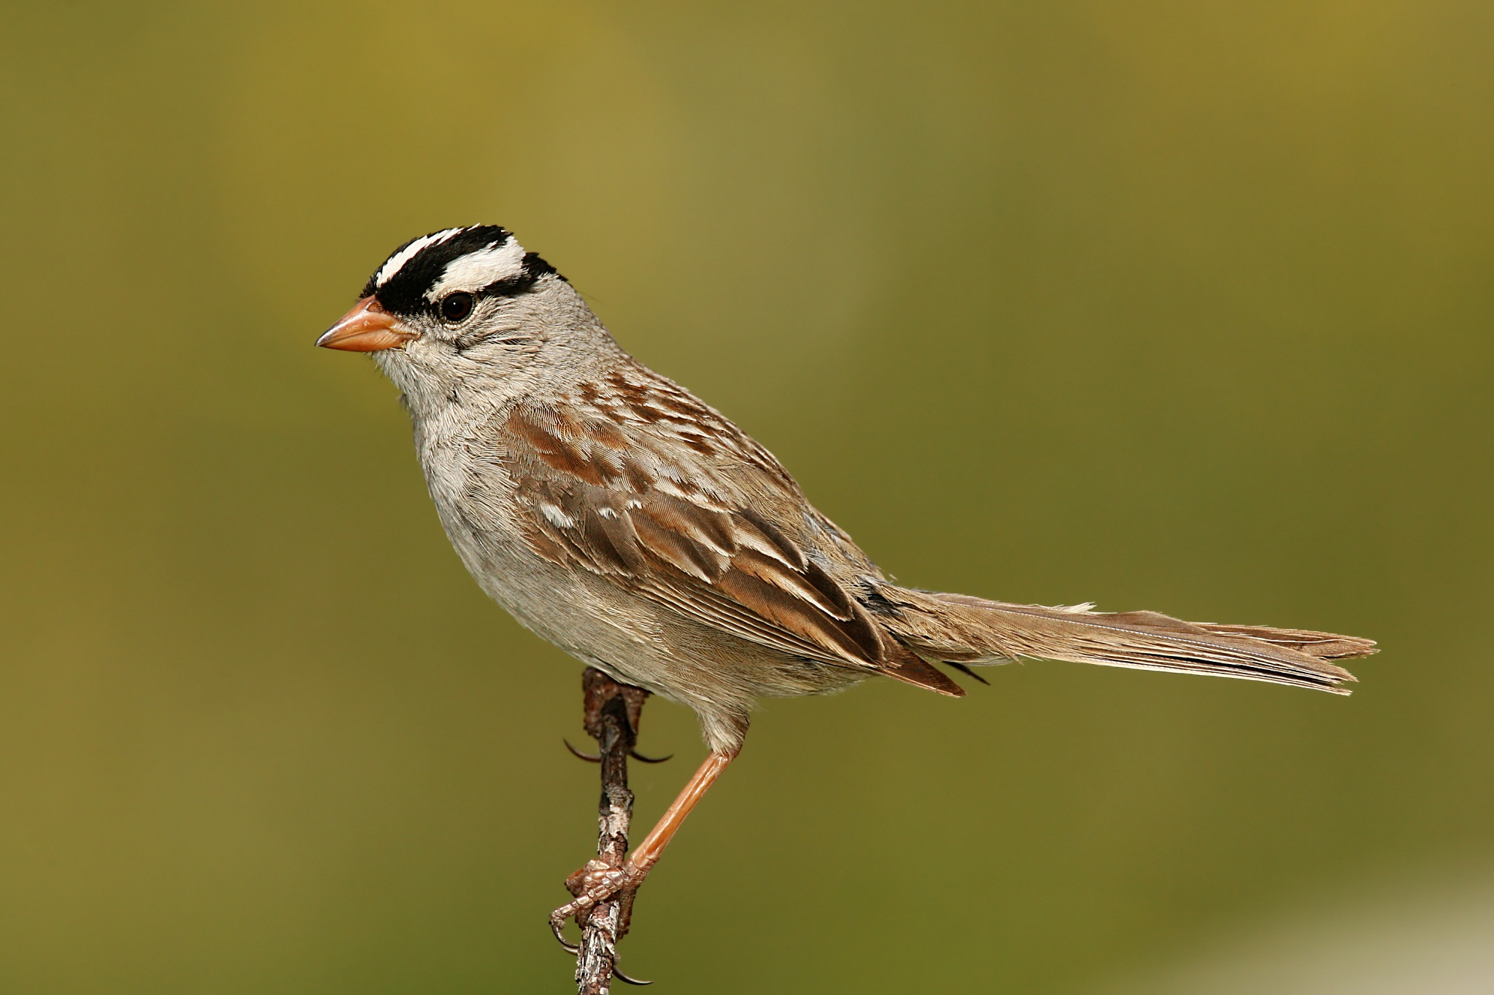
NEUR 411 · NEUROETHOLOGY · FALL 2026
Lecture 33
Vocal communication II: song learning, sensitive periods, the template model (Marler & Konishi)
Friday, November 13, 2026
Jordan Lopez, Ph.D.
Professor of Neurobiology & Biomedical Engineering
Photo: Wolfgang Wander, CC BY-SA 3.0. Wikimedia Commons.
Notes:
Vocal communication II: song learning, sensitive periods, the template model (Marler & Konishi)
Friday, November 13, 2026

Slide 2
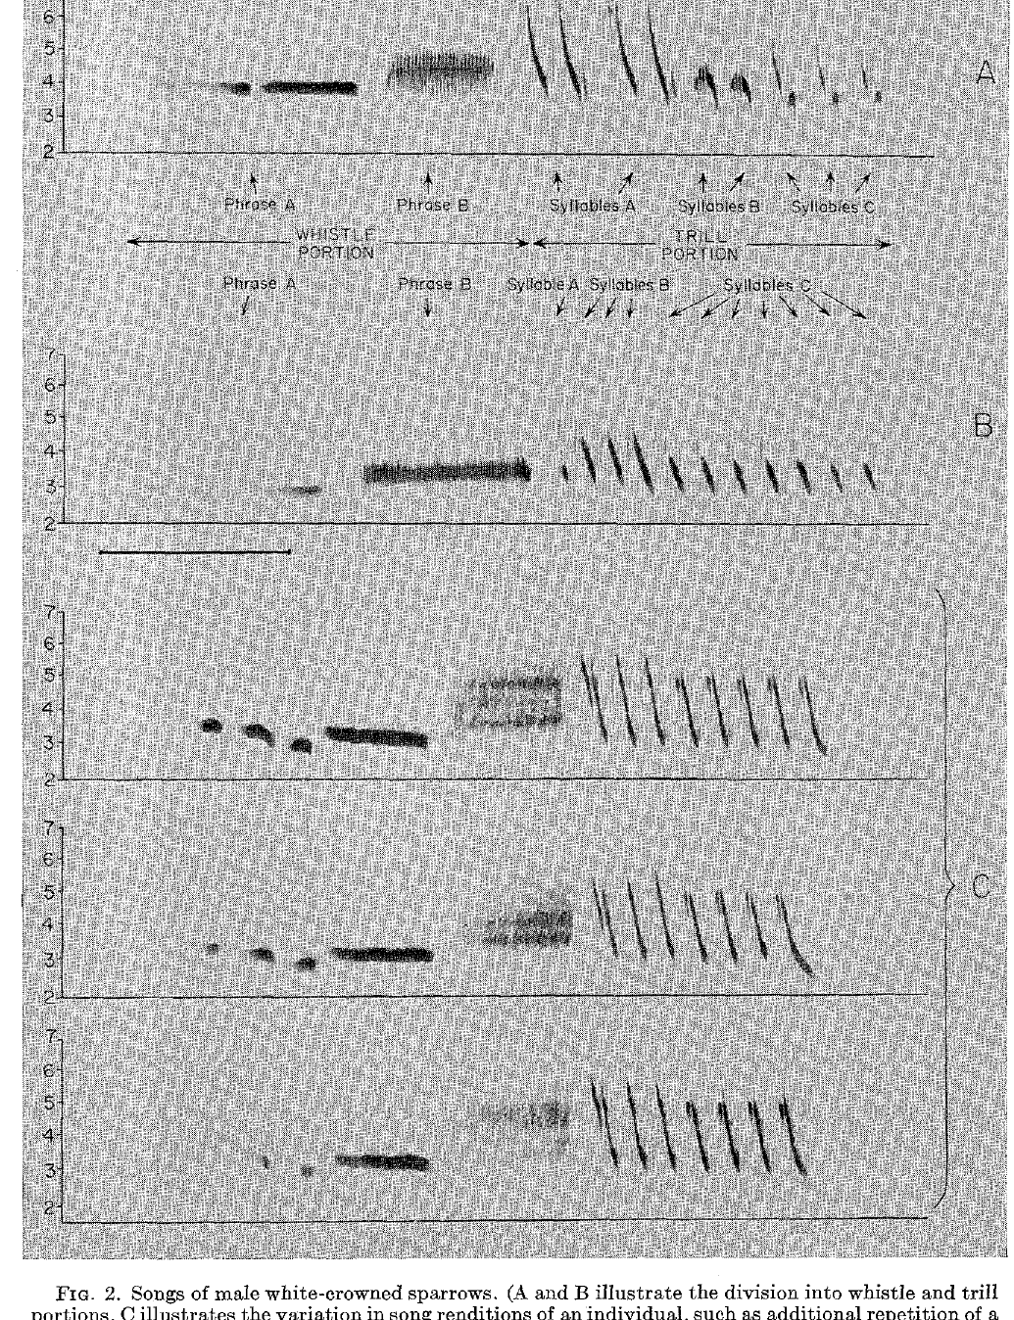
Song learning changes the structure of vocal output
Vocal learning changes the acoustic form of a sound through experience. In white-crowned sparrows, Zonotrichia leucophrys, males acquire distinctive song patterns from adult songs heard while young. This differs from learning when to emit a call that is already available to the bird.
Marler analyzed sound spectrograms, which display frequency against time. Whistle phrases and repeated trill syllables gave recognizable components for comparing a pupil's song with its training model. Each component could be followed through the recording from start to finish.
A song can keep its general whistle and trill organization while copying the tutor's detailed syllables only roughly. Vocal learning therefore depends on the acoustic structure of the song rather than on how often the bird sings. Frequency trajectories of each element separate a detailed copy from a broad resemblance.
Marler (1970), Fig. 2. Whistle and trill portions of male song.
Marler (1970)
2
Notes:
**Vocal learning** changes the acoustic form of a sound through experience. In white-crowned sparrows, _Zonotrichia leucophrys_, males acquire distinctive song patterns from adult songs heard while young. This differs from learning when to emit an already available call.
Marler analyzed sound spectrograms, which display frequency against time. Whistle phrases and repeated trill syllables provided recognizable components for comparing a pupil's song with its training model.
A song can preserve its general whistle–trill organization yet fail to reproduce the tutor's detailed syllables. Vocal learning therefore requires assessment of acoustic structure, rather than simply counting how often a bird sings.
Whistle portions are comparatively sustained sounds, while trills contain repeated acoustic elements. Their frequency trajectories and repetition patterns distinguish a detailed copy from broad resemblance.
References:
Marler P (1970). A comparative approach to vocal learning: Song development in white-crowned sparrows. Journal of Comparative and Physiological Psychology 71(2, Pt. 2): 1–25. https://doi.org/10.1037/h0029144

Slide 3
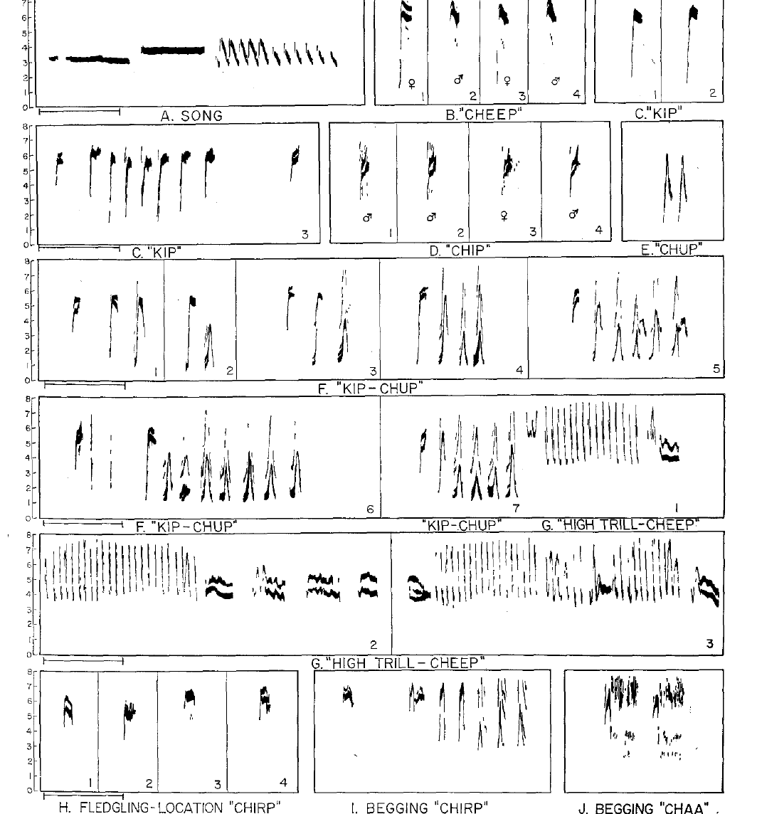
Song and calls have different developmental requirements
White-crowned sparrows produce several vocalizations, including short calls and the elaborate male song. A call is a relatively brief vocal signal, whereas the song contains organized whistle and trill components repeated during the breeding season. The two categories follow different developmental paths.
Marler's spectrograms distinguish adult calls from juvenile begging and location calls. Their different acoustic forms make it possible to identify which vocalization is being measured at each stage of development. Each recording can then be assigned to a single vocal category.
The learning experiments concern song structure in particular. The adult song is produced by males, while many shorter calls occur in both sexes. Each experiment therefore addresses the song repertoire rather than the full set of sounds the species produces.
Marler (1970), Fig. 1. Major song and call vocalizations.
Marler (1970)
3
Notes:
White-crowned sparrows produce several vocalizations, including short calls and the elaborate male song. A **call** is a relatively brief vocal signal; the song contains organized whistle and trill components repeated during the breeding season.
Marler's spectrograms distinguish adult calls from juvenile begging and location calls. Their different acoustic forms make it possible to identify which vocalization is being measured during development.
The learning experiments concern song structure, rather than every sound the species produces. Abnormal song after acoustic isolation cannot be generalized into a claim that all sparrow vocal behavior requires imitation.
The adult song is produced by males, whereas many shorter calls occur in both sexes. These differences prevent equating the song-learning experiment with acquisition of the entire vocal repertoire.
References:
Marler P (1970). A comparative approach to vocal learning: Song development in white-crowned sparrows. Journal of Comparative and Physiological Psychology 71(2, Pt. 2): 1–25. https://doi.org/10.1037/h0029144

Slide 4
Spectrograms separate juvenile calls from adult calls
Juvenile begging and location calls differ in acoustic form from adult calls. The spectrogram of each vocalization shows its frequency structure over time, which makes it possible to identify each vocal category before any learning is tested. The same display is applied to every recording in the study. Each vocal category is therefore fixed by its measured form.
Adult calls and the adult song are measured with the same spectrographic display. Keeping the call and song categories separate prevents developmental results about song from being applied to calls. Each category is analyzed against its own reference set of recordings, so its acoustic structure is compared only with the correct model.
Sorting each recording into its category at the start of the analysis keeps the learning experiments focused on song. A result about song structure then describes the song repertoire, while the calls are described on their own terms. This ordering makes every later comparison between tutors and pupils easier to follow.
Marler (1970), Fig. 1. Major song and call vocalizations.
Marler (1970)
3a
Notes:
Vocal categories are identified from their acoustic form.
Juvenile calls.
Begging and location calls are produced by young birds.
Their spectrograms differ from adult calls.
Adult calls.
Adult calls form a separate category from song.
Each category is measured with the same display.
Separation.
Categories are sorted at the start of the analysis.
Song results do not carry over to calls.
Meaning.
The spectrogram gives a reliable basis for classification.
Learning is tested within the song category.
Source values.
The published recordings and measurements come from the original paper.
Each result is reported with the condition used in the source.
Why the measure matters.
The result separates the measured property from the mechanism that produces it.
The comparison stays within the same birds, cells or recordings.
Interpretation.
Each result is read within the preparation and the age group that produced it.
The claim is restricted to the measured birds and conditions.
Context.
The parent figure shows the measurement that the paragraphs describe.
Each claim is tied to the recordings of the original study.
References:
Marler P (1970). A comparative approach to vocal learning: Song development in white-crowned sparrows. Journal of Comparative and Physiological Psychology 71(2, Pt. 2): 1–25. https://doi.org/10.1037/h0029144

Slide 5
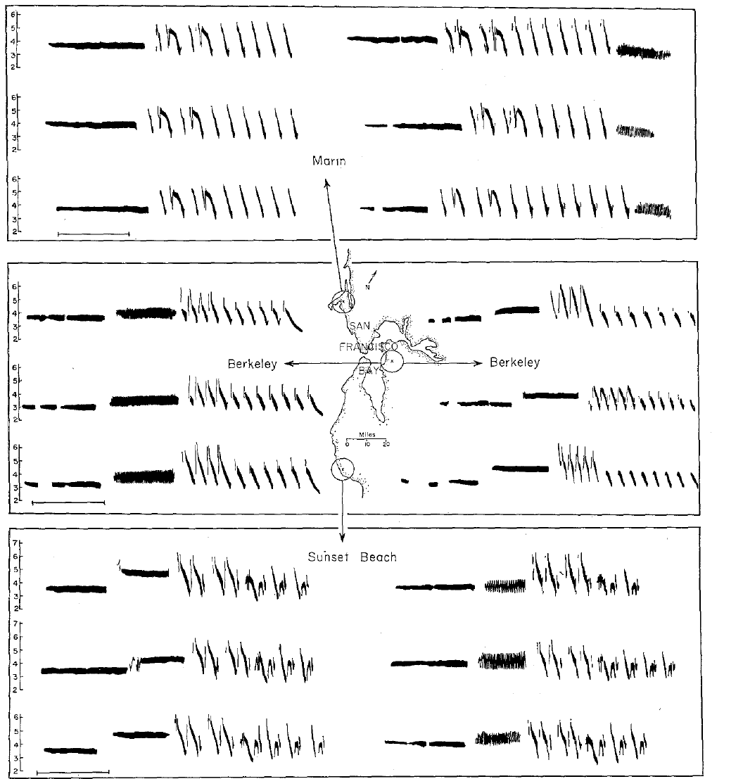
Local dialects provide acoustic models for learning
A dialect is a song pattern shared within a local population but differing from patterns elsewhere in the same species. Marler compared white-crowned sparrow songs from several parts of the San Francisco Bay area.
The populations shared broad species characteristics while differing in syllable structure and arrangement. These differences supplied alternative training models whose distinctive details could be recognized in later songs.
Geographical resemblance alone does not establish learning, because neighboring birds can also share ancestry and habitat. Controlled exposure to a particular dialect was required to separate the acoustic model from the bird's place of origin.
An alien dialect is still conspecific song. Learning its details would separate the source of an acoustic pattern from the pupil’s geographical population of origin.
Marler (1970), Fig. 3. Local song dialects.
Marler (1970)
4
Notes:
A **dialect** is a song pattern shared within a local population but differing from patterns elsewhere in the same species. Marler compared white-crowned sparrow songs from several parts of the San Francisco Bay area.
The populations shared broad species characteristics while differing in syllable structure and arrangement. These differences supplied alternative training models whose distinctive details could be recognized in later songs.
Geographical resemblance alone does not establish learning, because neighboring birds can also share ancestry and habitat. Controlled exposure to a particular dialect was required to separate the acoustic model from the bird's place of origin.
An alien dialect is still conspecific song. Learning its details would separate the source of an acoustic pattern from the pupil’s geographical population of origin.
References:
Marler P (1970). A comparative approach to vocal learning: Song development in white-crowned sparrows. Journal of Comparative and Physiological Psychology 71(2, Pt. 2): 1–25. https://doi.org/10.1037/h0029144

Slide 6
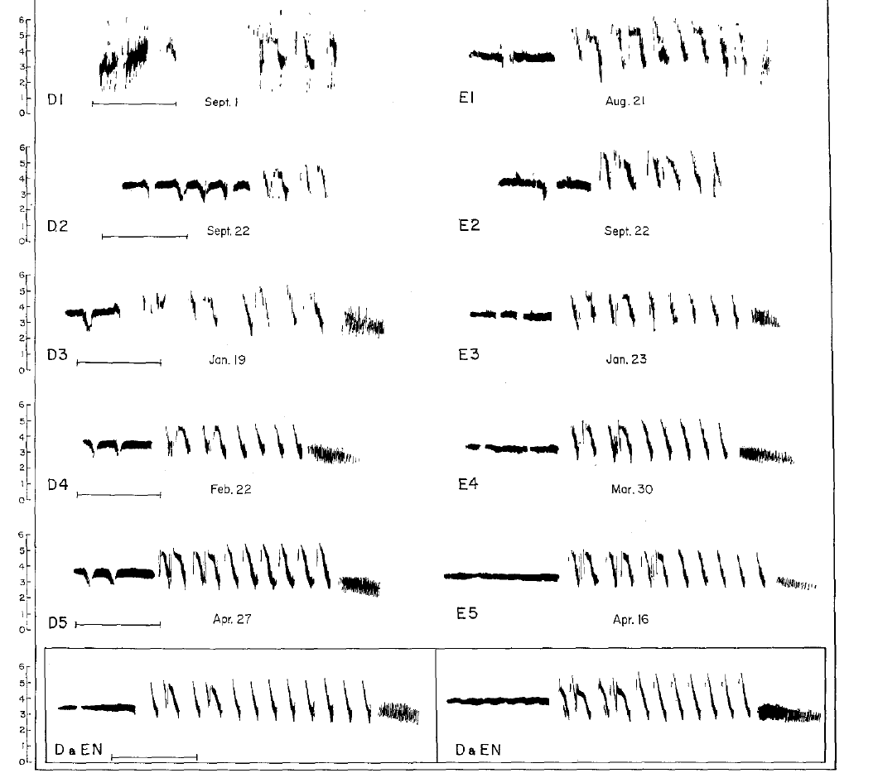
Field experience can precede laboratory isolation
A bird brought into isolation after time in the wild may already have heard a usable song model. Marler distinguished birds collected after fledging from birds collected as very young nestlings. The collection age determines how much acoustic experience each bird brings into the laboratory.
Songs of birds isolated after early field experience could retain local dialect characteristics. Such songs show that learning before capture can persist in adult output. Comparison songs from the capture area give a reference for identifying those retained dialect details.
The age and acoustic history at collection form part of the experimental treatment. Removing a bird from its natural environment keeps the information acquired before capture, and this information can appear in the full song that emerges much later. Each bird's history is therefore recorded alongside its song.
Marler (1970), Fig. 4. Development following early field experience.
Marler (1970)
5
Notes:
A bird brought into isolation after spending time in the wild may already have heard a usable song model. Marler distinguished birds collected after fledging from birds collected as very young nestlings.
The songs of birds isolated after early field experience could retain local dialect characteristics. Those outcomes cannot be interpreted as normal development in the complete absence of adult song.
The age and acoustic history at collection are therefore part of the experimental treatment. Removing a bird from its natural environment does not erase information acquired before capture, even when its full song emerges much later.
The comparison songs from the capture area provide a reference for identifying retained dialect details. Without that reference, normal-looking adult structure cannot identify the source of learning.
References:
Marler P (1970). A comparative approach to vocal learning: Song development in white-crowned sparrows. Journal of Comparative and Physiological Psychology 71(2, Pt. 2): 1–25. https://doi.org/10.1037/h0029144

Slide 7
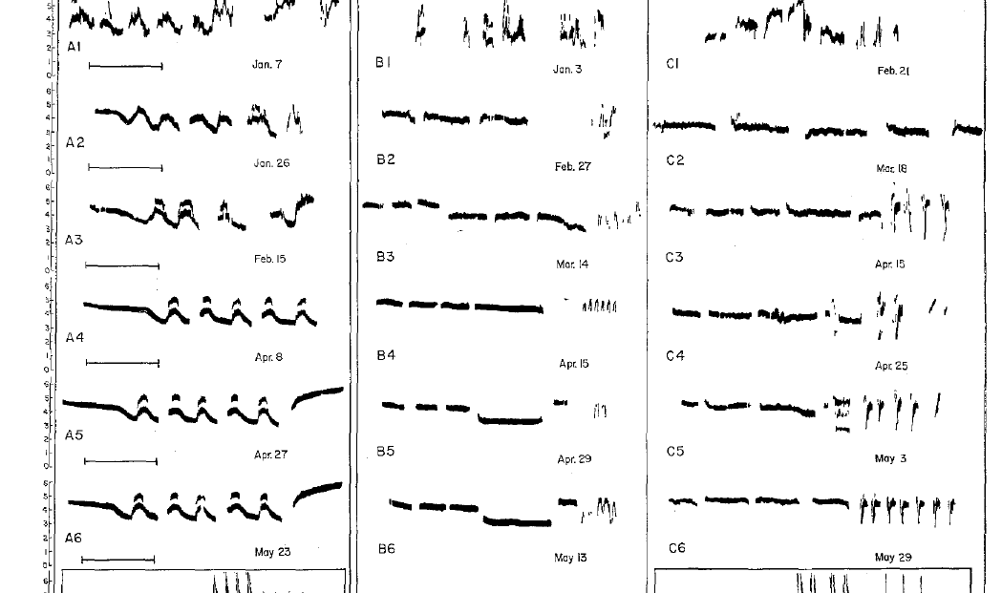
Early isolation prevents normal song development
Acoustic isolation excludes the adult song models normally available during development. Marler reared nestling white-crowned sparrows without normal adult song and compared their later vocalizations with natural dialects.
The isolates still sang, but their songs were simplified or abnormal in detailed syllable structure. Production of sound was therefore preserved while normal organization of the learned song was disrupted.
Isolation separates spontaneous vocal development from experience-dependent refinement. It does not imply that every component is learned: some broad tendencies can emerge without tutoring, while the detailed adult pattern depends on an appropriate acoustic environment.
The isolates’ developmental series retain a record of earlier vocal forms. Comparing only their final songs would conceal the gradual emergence of the abnormal mature patterns.
Marler (1970), Fig. 5. Song development in acoustic isolation.
Marler (1970)
6
Notes:
**Acoustic isolation** excludes the adult song models normally available during development. Marler reared nestling white-crowned sparrows without normal adult song and compared their later vocalizations with natural dialects.
The isolates still sang, but their songs were simplified or abnormal in detailed syllable structure. Production of sound was therefore preserved while normal organization of the learned song was disrupted.
Isolation separates spontaneous vocal development from experience-dependent refinement. It does not imply that every component is learned: some broad tendencies can emerge without tutoring, while the detailed adult pattern depends on an appropriate acoustic environment.
The isolates’ developmental series retain a record of earlier vocal forms. Comparing only their final songs would conceal the gradual emergence of the abnormal mature patterns.
References:
Marler P (1970). A comparative approach to vocal learning: Song development in white-crowned sparrows. Journal of Comparative and Physiological Psychology 71(2, Pt. 2): 1–25. https://doi.org/10.1037/h0029144

Slide 8
Isolate songs keep a record of abnormal development
A developmental series is a set of recordings made at successive ages from the same bird. Marler recorded the isolates repeatedly, so each song can be compared with the songs that came before it. The series shows the path from early vocal forms to the final abnormal form, and it reveals each step along that path.
Syllable structure in the isolates changed over the course of development before reaching its abnormal mature state. Each stage of that change is visible when the recordings are arranged by age. Final songs alone would hide the stages, so the full series is needed to see how the mature pattern was assembled.
The isolates' developmental records show how the abnormal pattern was built. Tracking the record from earlier to later stages links the mature song to its origin in isolation, rather than treating it as a fixed endpoint. Each bird supplies its own history, and the pattern is read as a sequence of developmental steps.
Marler (1970), Fig. 5. Song development in acoustic isolation.
Marler (1970)
6a
Notes:
A developmental series shows how the adult song was built.
Recordings.
Each isolate was recorded at successive ages.
The same bird is followed through development.
Stages.
Syllable structure changed before the abnormal mature state.
Each stage is visible when recordings are ordered by age.
Final songs.
The final song alone hides the stages.
The series makes the origin of the pattern visible.
Meaning.
The abnormal adult song has a developmental history.
The history links the mature song to isolation.
Source values.
The published recordings and measurements come from the original paper.
Each result is reported with the condition used in the source.
Why the measure matters.
The result separates the measured property from the mechanism that produces it.
The comparison stays within the same birds, cells or recordings.
Interpretation.
Each result is read within the preparation and the age group that produced it.
The claim is restricted to the measured birds and conditions.
Context.
The parent figure shows the measurement that the paragraphs describe.
Each claim is tied to the recordings of the original study.
References:
Marler P (1970). A comparative approach to vocal learning: Song development in white-crowned sparrows. Journal of Comparative and Physiological Psychology 71(2, Pt. 2): 1–25. https://doi.org/10.1037/h0029144

Slide 9
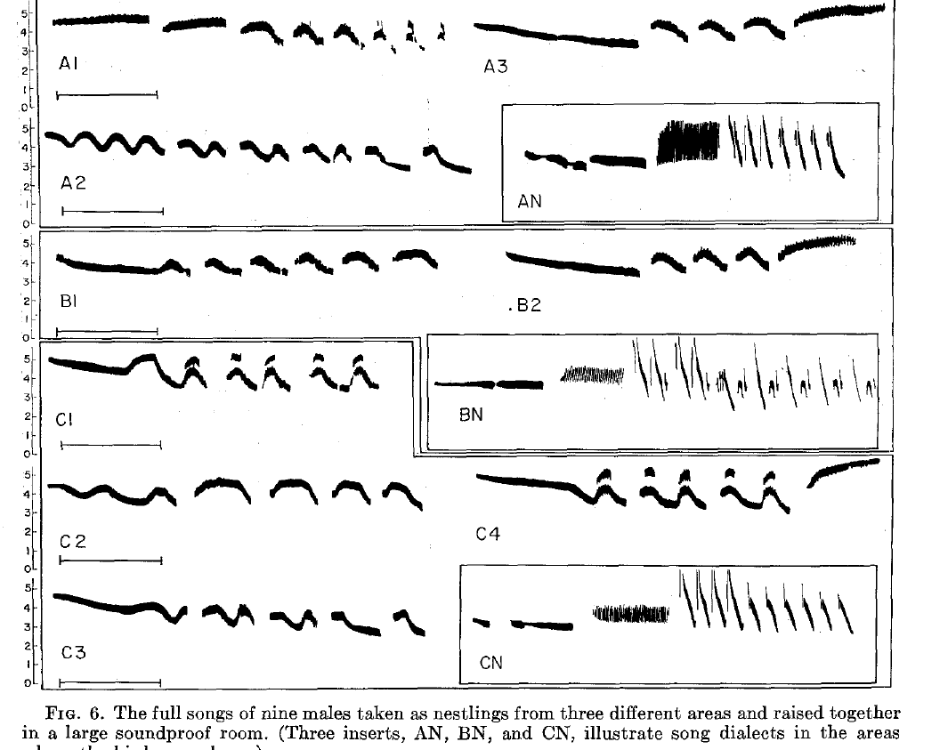
Young companions do not replace an adult song model
Marler raised young white-crowned sparrows together while excluding adult song. Group isolation preserves interactions among young birds but removes the normal adult acoustic model. The design tests whether companions of the same age can substitute for a tutor.
The resulting songs remained abnormal. Developing vocalizations from companions did not supply the information carried by an established adult dialect under these conditions. Access to other young birds therefore did not restore the learned pattern.
This comparison separates access to other birds from access to an appropriate tutor. A group provides social stimulation without the mature song pattern needed for accurate imitation. Individual and group isolation produced similar abnormal songs, which identifies the missing adult model as the variable that matters.
Marler (1970), Fig. 6. Songs of group-isolated males.
Marler (1970)
7
Notes:
Marler also raised young white-crowned sparrows together while excluding adult song. **Group isolation** preserves interactions among young birds but removes the normal adult acoustic model.
The resulting songs remained abnormal. Their companions' developing vocalizations did not supply the same information as an established adult dialect under these experimental conditions.
This comparison distinguishes access to other birds from access to an appropriate tutor. A group can provide social stimulation without providing the mature song pattern needed for accurate imitation; the result does not establish that social interactions are irrelevant to learning.
Individual and group isolation both removed adult song. Their similar abnormal outcomes in this study identify a missing adult model rather than simply the absence of young companions.
References:
Marler P (1970). A comparative approach to vocal learning: Song development in white-crowned sparrows. Journal of Comparative and Physiological Psychology 71(2, Pt. 2): 1–25. https://doi.org/10.1037/h0029144

Slide 10
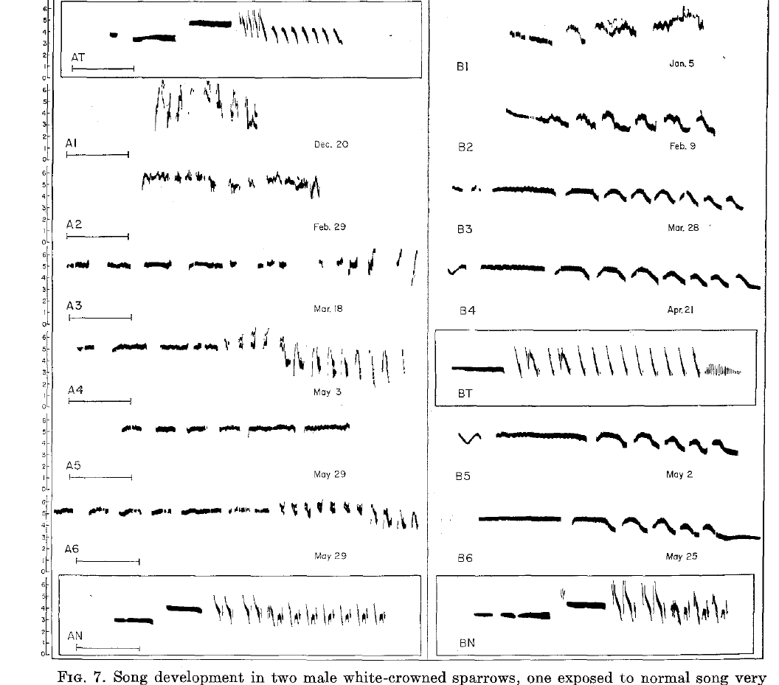
Very early playback does not guarantee song copying
Playback presents a recorded song to a bird under controlled conditions. Marler tested playback during the nestling phase and followed the later development of isolated males. Each male's final song shows whether the early recording was stored and reproduced.
Exposure before about 10 days of age produced far less detailed copying than effective early fledgling training. The timing of a playback therefore decides whether its pattern is kept as a song model. Early recordings can be heard without being stored as models.
The distinction concerns responsiveness to the tested recordings. Other kinds of early sensory experience can still shape development in their own ways, and the copying result applies to the song-model effect alone. Each recording's effect is measured by the copy it later produces.
Marler (1970), Fig. 7. Development after very early or late exposure.
Marler (1970)
8
Notes:
Song exposure can be ineffective even when it occurs before the usual learning interval. Marler tested playback during the nestling phase and followed the later development of isolated males.
Exposure before about 10 days of age did not produce detailed copying comparable to effective early fledgling training. An acoustic signal's presence therefore does not by itself establish that the bird stores it as a song model.
The distinction concerns developmental responsiveness to the tested recordings. It does not establish an inability to hear every sound, nor does it imply that all kinds of early sensory experience have no developmental effects.
References:
Marler P (1970). A comparative approach to vocal learning: Song development in white-crowned sparrows. Journal of Comparative and Physiological Psychology 71(2, Pt. 2): 1–25. https://doi.org/10.1037/h0029144

Slide 11
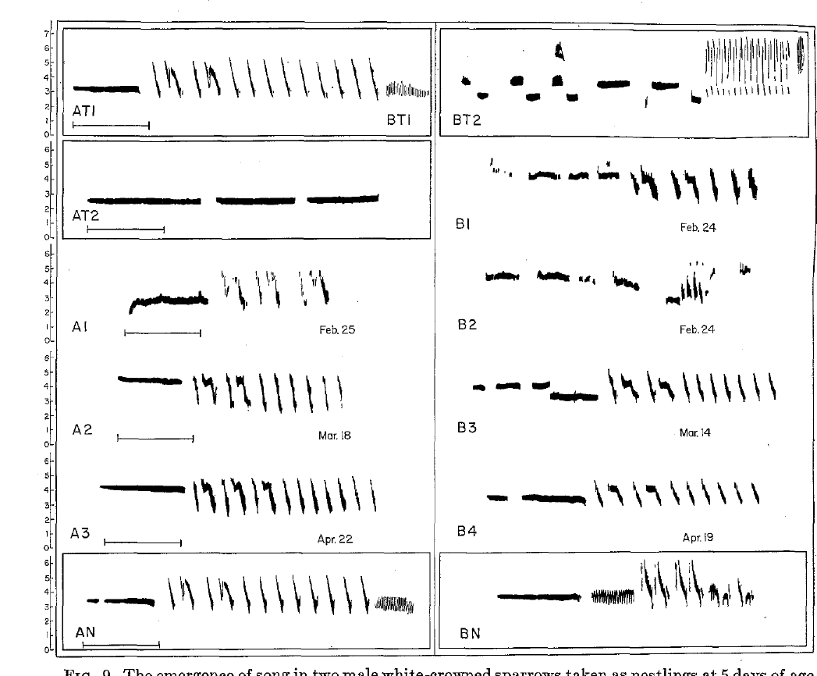
Early fledgling tutoring supports detailed imitation
Marler presented recorded songs to otherwise isolated young males during defined age intervals. Early tutoring included exposure from days 8–28 or days 35–56, followed by development without continued adult song.
The eventual songs were good copies of the white-crowned sparrow model, although a final vibrato component could be missing. Imitation here means reproduction of identifiable acoustic details, rather than merely a broadly normal song.
Because the mature song appeared long after tutoring, the recordings must have influenced information retained for later vocal development. The behavioral experiment establishes delayed learning without locating the stored information in a particular neuron.
After the recorded exposure ended, the young males remained isolated. Subsequent resemblance to the earlier model therefore did not require continued availability of that recording during mature singing.
Marler (1970), Fig. 9. Development after early conspecific and alien tutoring.
Marler (1970)
9
Notes:
Marler presented recorded songs to otherwise isolated young males during defined age intervals. Early tutoring included exposure from days 8–28 or days 35–56, followed by development without continued adult song.
The eventual songs were good copies of the white-crowned sparrow model, although a final vibrato component could be missing. **Imitation** here means reproduction of identifiable acoustic details, rather than merely a broadly normal song.
Because the mature song appeared long after tutoring, the recordings must have influenced information retained for later vocal development. The behavioral experiment establishes delayed learning without locating the stored information in a particular neuron.
After the recorded exposure ended, the young males remained isolated. Subsequent resemblance to the earlier model therefore did not require continued availability of that recording during mature singing.
References:
Marler P (1970). A comparative approach to vocal learning: Song development in white-crowned sparrows. Journal of Comparative and Physiological Psychology 71(2, Pt. 2): 1–25. https://doi.org/10.1037/h0029144

Slide 12
Tutoring intervals set which copies are retained
A tutoring interval is the span of ages during which a pupil hears the model. Both of Marler's windows, days 8–28 and days 35–56, produced good copies in otherwise isolated males. Tutoring within either interval was therefore sufficient for detailed copying, and the windows can be compared directly because the rest of the procedure was identical.
The copies followed the training recordings closely, and the recordings stopped before the mature song appeared. The copied material must therefore have been retained through the interval rather than sung back during the tutoring itself. Each male's final song is compared with its own training recording, which makes the match specific to that bird.
The retention pattern separates the timing of tutoring from the timing of performance. A model heard in one interval can shape a song that emerges far later, which makes the tutoring interval the key variable. Each interval therefore sets which information is kept until the adult song develops.
Marler (1970), Fig. 9. Development after early conspecific and alien tutoring.
Marler (1970)
9a
Notes:
The tutoring interval controls what the pupil retains.
Windows.
Two age windows were tested, from days 8–28 and days 35–56.
Both produced good copies.
Copies.
The copies matched the training recordings closely.
The recordings ended before the mature song.
Retention.
Material was kept through the interval.
It was later used in the mature song.
Timing.
Learning and performance occur at different times.
The interval is the key variable.
Source values.
The published recordings and measurements come from the original paper.
Each result is reported with the condition used in the source.
Why the measure matters.
The result separates the measured property from the mechanism that produces it.
The comparison stays within the same birds, cells or recordings.
Interpretation.
Each result is read within the preparation and the age group that produced it.
The claim is restricted to the measured birds and conditions.
Context.
The parent figure shows the measurement that the paragraphs describe.
Each claim is tied to the recordings of the original study.
References:
Marler P (1970). A comparative approach to vocal learning: Song development in white-crowned sparrows. Journal of Comparative and Physiological Psychology 71(2, Pt. 2): 1–25. https://doi.org/10.1037/h0029144

Slide 13
A brief playback schedule can supply a usable model
In Marler's early training experiment, pupils heard two minutes of white-crowned sparrow song and two minutes of another species' song in morning and afternoon sessions. Presentation order alternated across sessions and days. This alternating schedule tested learning from brief, repeated exposure.
The recordings were played at six songs per minute. Learning therefore occurred from controlled episodes of exposure rather than from continuous access to a singing adult throughout development. The schedule kept the amount of exposure fixed across pupils.
Alternating the order reduced a simple presentation-order explanation for selective copying. The experiment established that this schedule supports learning. Harris' sparrow song resembles white-crowned sparrow song more closely than the tested song sparrow recording, and neither alien pattern left a recognizable trace in the copied songs.
Marler (1970), Fig. 9. Development after early conspecific and alien tutoring.
Marler (1970)
10
Notes:
In Marler's early training experiment, pupils heard two minutes of white-crowned sparrow song and two minutes of another species' song in morning and afternoon sessions. Presentation order alternated across sessions and days.
The recordings were played at six songs per minute. Effective learning therefore occurred from controlled episodes of exposure, rather than continuous access to a singing adult throughout development.
Alternating the order reduced a simple presentation-order explanation for selective copying. The experiment established that this schedule could support learning; it did not determine the minimum exposure required or prove that live tutoring and recorded tutoring are equivalent.
Harris’ sparrow song resembles white-crowned sparrow song more closely than the tested song sparrow recording. Neither alien pattern left a recognizable trace in the resulting copied songs.
References:
Marler P (1970). A comparative approach to vocal learning: Song development in white-crowned sparrows. Journal of Comparative and Physiological Psychology 71(2, Pt. 2): 1–25. https://doi.org/10.1037/h0029144

Slide 14
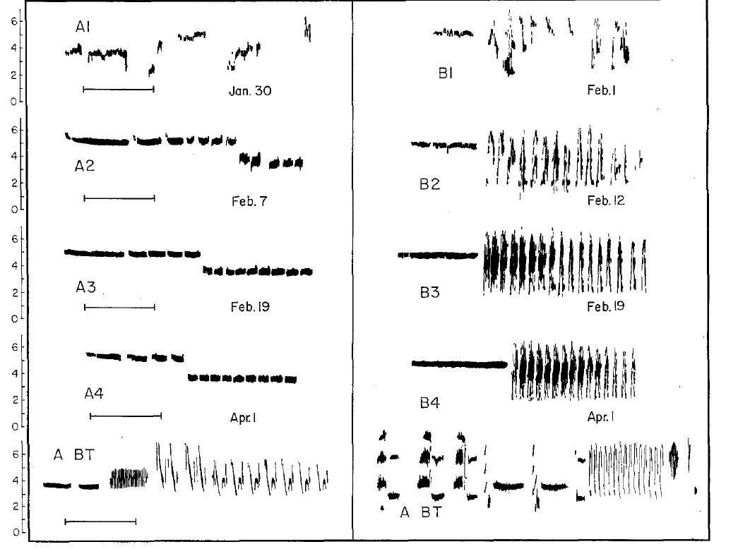
Later tutoring can spare organization without fine copying
Pupils trained from days 50–71 did not reproduce the training models in detailed syllable form. One developed an isolate-like song, whereas another retained a more normal division into whistle and trill portions. The two outcomes separate coarse organization from fine copying.
A late experience can shift development toward species-typical structure without installing the detailed features obtained after earlier training. The whistle and trill division is a coarse organizational feature that survived in one late-trained male. Its survival did not include matching the model's detailed trill syllables.
A sensitive period is an interval of enhanced responsiveness to experience. Its boundary depends on the measured outcome, so detailed imitation and general song organization can close at different ages. Each outcome therefore marks a different boundary.
Marler (1970), Fig. 10. Development after tutoring on days 50–71.
Marler (1970)
11
Notes:
Pupils trained from days 50–71 did not reproduce the training models in detailed syllable form. One developed an isolate-like song, whereas another retained a more normal division into whistle and trill portions.
This partial outcome distinguishes coarse song organization from accurate copying. A late experience can shift development toward species-typical structure without installing all the detailed features obtained after earlier training.
A **sensitive period** is an interval of enhanced responsiveness to experience. Its boundary depends on the measured outcome: loss of detailed imitation need not coincide with complete loss of every developmental influence from song exposure.
The whistle and trill division is a coarse organizational feature. Its survival in one late-trained male did not include matching the model’s detailed trill syllables.
References:
Marler P (1970). A comparative approach to vocal learning: Song development in white-crowned sparrows. Journal of Comparative and Physiological Psychology 71(2, Pt. 2): 1–25. https://doi.org/10.1037/h0029144

Slide 15
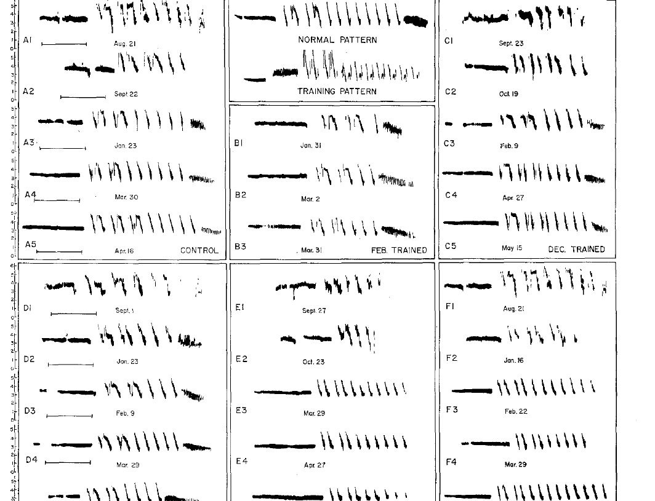
Late exposure does not simply rewrite established song
Marler tested song exposure at later ages as well as in early development. Playback around or after 100 days failed to produce the detailed reproduction associated with the earlier effective interval. The timing of the tested playbacks sets the outcome for each age group.
The outcome contrasts with the ability of younger pupils to acquire a specific dialect. Developmental age changed the effect of an acoustic model that was otherwise suitable for the species. The same procedure was applied across ages, so the contrast reflects age.
These findings concern the tested subspecies and playback conditions. They show an age-dependent limit on detailed song acquisition in these birds. Late field-collected birds also carried earlier acoustic histories, which set the baseline for each new playback effect.
Marler (1970), Fig. 8. Songs after later field collection and playback.
Marler (1970)
12
Notes:
Marler tested song exposure at later ages as well as in early development. Playback around or after 100 days did not yield the detailed training-song reproduction associated with the earlier effective interval.
The outcome contrasts with the ability of younger pupils to acquire a specific dialect. Developmental age changed the effect of an acoustic model that could otherwise be suitable for the species.
These findings concern the tested subspecies and playback conditions. They support an age-dependent limitation on detailed song acquisition, rather than a universal rule that every songbird must stop learning at the same chronological age.
The later field-collected birds also had earlier acoustic histories. Their exposure records matter when distinguishing a new playback effect from information acquired before laboratory testing.
References:
Marler P (1970). A comparative approach to vocal learning: Song development in white-crowned sparrows. Journal of Comparative and Physiological Psychology 71(2, Pt. 2): 1–25. https://doi.org/10.1037/h0029144

Slide 16
Playback timing decides whether detailed copying occurs
Marler compared playback at several ages to ask when a recording can be stored as a song model. Early intervals produced detailed copies, whereas playback around or after 100 days did not. The age of playback is therefore the variable that changes the outcome.
Developmental age changed the effect of the same kind of acoustic model. Each age group heard a conspecific model that was otherwise suitable for the species, so the difference lies in the bird's developmental stage rather than in the recording. The age groups were compared under the same playback schedule, which keeps the stimulus constant across the contrast.
The contrast shows a window in which detailed song copying is possible. Recognizing that window makes it possible to compare early and late playback under the same procedure. The same comparison also tells the reader which age interval produces detailed copies and which does not.
Marler (1970), Fig. 8. Songs after later field collection and playback.
Marler (1970)
12a
Notes:
Playback timing changes the outcome of song copying.
Early playback.
Early intervals produced detailed copies.
Copies matched the training model.
Late playback.
Playback around or after 100 days produced no detailed reproduction.
The model was otherwise suitable.
Stage.
The difference reflects the bird's developmental stage.
The recording itself is the same kind.
Window.
A window for detailed copying can be identified.
Early and late playback can be compared under one procedure.
Source values.
The published recordings and measurements come from the original paper.
Each result is reported with the condition used in the source.
Why the measure matters.
The result separates the measured property from the mechanism that produces it.
The comparison stays within the same birds, cells or recordings.
Interpretation.
Each result is read within the preparation and the age group that produced it.
The claim is restricted to the measured birds and conditions.
Context.
The parent figure shows the measurement that the paragraphs describe.
Each claim is tied to the recordings of the original study.
References:
Marler P (1970). A comparative approach to vocal learning: Song development in white-crowned sparrows. Journal of Comparative and Physiological Psychology 71(2, Pt. 2): 1–25. https://doi.org/10.1037/h0029144

Slide 17
Conspecific and alien songs are not learned equally
A conspecific is a member of the same species, whereas a heterospecific belongs to another species. Marler presented conspecific song alongside Harris' sparrow or song sparrow recordings during early tutoring. Both kinds of model were therefore available at once.
The young white-crowned sparrows later copied the conspecific model, while recognizable effects of the other species' songs were absent. Equal availability of acoustic examples produced unequal incorporation into adult song. This selectivity supports a bias toward suitable song patterns.
Failing to imitate a signal differs from failing to detect it, so the comparison measures what the pupil copied. The alien recordings were supplied in addition to conspecific tutoring. The resulting choice of pattern reflects selectivity under simultaneous access to both categories of model.
Marler (1970), Fig. 9. Development after early conspecific and alien tutoring.
Marler (1970)
13
Notes:
A **conspecific** is a member of the same species; a heterospecific belongs to another species. Marler presented conspecific song alongside Harris' sparrow or song sparrow recordings during early tutoring.
The young white-crowned sparrows later copied the conspecific model, while recognizable effects of the other species' songs were absent. Equal availability of acoustic examples did not produce equal incorporation into adult song.
Selective acquisition supports a bias toward suitable song patterns. The comparison does not prove that alien songs were inaudible, because failing to imitate a signal and failing to detect it are different experimental outcomes.
The alien recordings were supplied in addition to conspecific tutoring. The resulting choice of copied pattern concerns selectivity under simultaneous access to those two categories of acoustic model.
References:
Marler P (1970). A comparative approach to vocal learning: Song development in white-crowned sparrows. Journal of Comparative and Physiological Psychology 71(2, Pt. 2): 1–25. https://doi.org/10.1037/h0029144

Slide 18
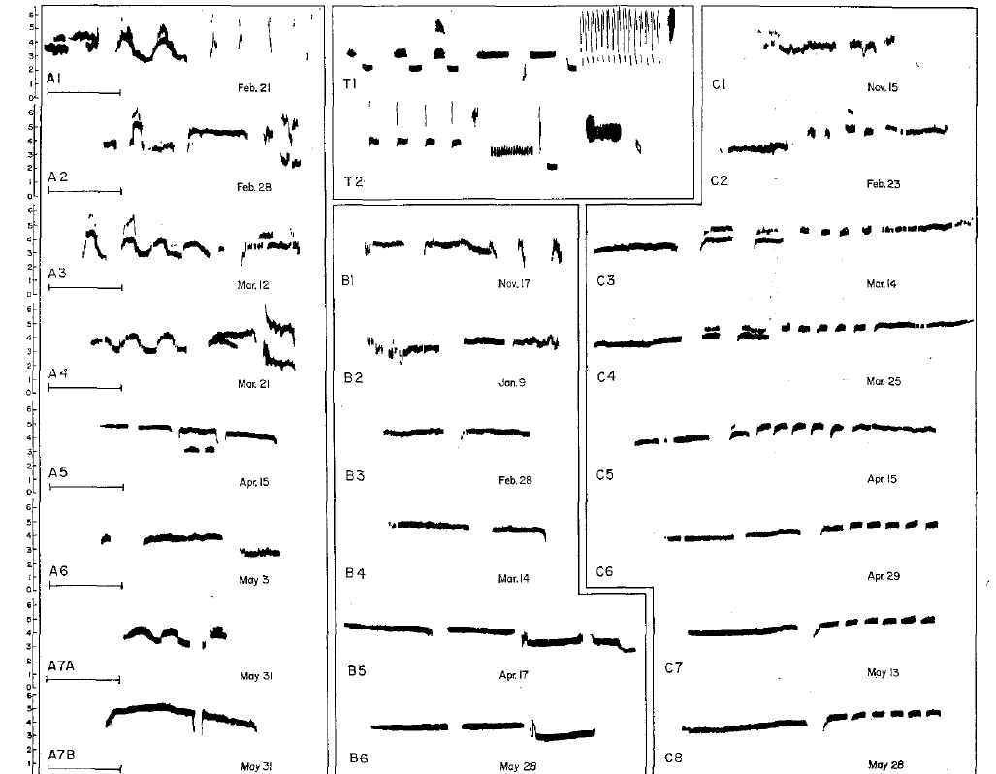
Alien song alone does not restore normal development
Marler tested whether excluding a competing conspecific model would permit white-crowned sparrows to copy song sparrow song. Individually isolated nestlings received the alien recordings from days 7–28.
Their later songs showed no detectable correspondence to those training songs and remained abnormal as white-crowned sparrow songs. The result differed from successful conspecific tutoring during a similar early interval.
The failure was therefore not explained solely by choosing a familiar conspecific model over an alien alternative. Under this playback procedure, another species' song did not provide an effective substitute for the acoustic information required for normal development.
Presenting alien song alone removed conspecific competition during training. The absence of recognizable alien copying nevertheless persisted, while the birds still developed their own abnormal songs.
Marler (1970), Fig. 11. Development with alien song alone.
Marler (1970)
14
Notes:
Marler tested whether excluding a competing conspecific model would permit white-crowned sparrows to copy song sparrow song. Individually isolated nestlings received the alien recordings from days 7–28.
Their later songs showed no detectable correspondence to those training songs and remained abnormal as white-crowned sparrow songs. The result differed from successful conspecific tutoring during a similar early interval.
The failure was therefore not explained solely by choosing a familiar conspecific model over an alien alternative. Under this playback procedure, another species' song did not provide an effective substitute for the acoustic information required for normal development.
Presenting alien song alone removed conspecific competition during training. The absence of recognizable alien copying nevertheless persisted, while the birds still developed their own abnormal songs.
References:
Marler P (1970). A comparative approach to vocal learning: Song development in white-crowned sparrows. Journal of Comparative and Physiological Psychology 71(2, Pt. 2): 1–25. https://doi.org/10.1037/h0029144

Slide 19
A learned target can guide vocalizations months later
An auditory template is a proposed internal specification against which developing vocal output can be evaluated. Marler inferred such a specification from early song exposure followed by much later reproduction of the training pattern. The template links a stored target with a later motor match.
The model separates acquiring a target from producing a mature imitation. A pupil can retain information about a song long before the vocal system produces the final whistle and trill sequence. The retained target then guides the matching of vocal output.
The template is a functional hypothesis about information storage and matching. Accurate copying after a delay supports a retained target, and the behavioral data point to its function rather than its cellular location. The stored form is therefore described in terms of the copy it guides.
Marler (1970), Fig. 9. Development after early conspecific and alien tutoring.
Marler (1970)
15
Notes:
An **auditory template** is a proposed internal specification against which developing vocal output can be evaluated. Marler inferred such a specification from early song exposure followed by much later reproduction of the training pattern.
The model separates acquiring a target from producing a mature imitation. A pupil can retain information about a song before the vocal system produces its final whistle and trill sequence.
The template is a functional hypothesis about information storage and matching. Accurate copying after a delay supports a retained target, but these behavioral data do not identify its cellular location or demonstrate a literal stored spectrogram.
References:
Marler P (1970). A comparative approach to vocal learning: Song development in white-crowned sparrows. Journal of Comparative and Physiological Psychology 71(2, Pt. 2): 1–25. https://doi.org/10.1037/h0029144

Slide 20
Two phases connect a model to later singing
The sensory phase is the period in which a pupil acquires information from its tutor. The sensorimotor phase follows, in which the bird uses that stored information to shape its own vocal output. The two phases can be separated by a long interval, and each one can be measured on its own terms.
Marler's delayed imitation shows that the retained information can guide singing months after the tutor was heard. The review by Brainard and Doupe (2000) supports a separate requirement for auditory feedback during refinement. The retained information therefore lasts through a long interval without further exposure.
Each phase has its own requirement. Acquisition depends on the tutor's song, while refinement depends on the bird's ability to hear its developing output. The two requirements are therefore measured by different manipulations, and both are needed to explain how a learned song reaches its adult form.
Marler (1970), Fig. 9. Development after early conspecific and alien tutoring.
Marler (1970); Brainard & Doupe (2000)
15a
Notes:
Acquisition and refinement are separate phases of learning.
Sensory phase.
The pupil acquires information from its tutor.
The information is kept for later use.
Sensorimotor phase.
The bird uses stored information to shape its output.
The phase follows a long interval.
Delayed imitation.
Retained information guides singing months later.
The model was heard well before singing.
Feedback.
Hearing one's own output supports refinement.
Each phase has its own requirement.
Source values.
The published recordings and measurements come from the original paper.
Each result is reported with the condition used in the source.
Why the measure matters.
The result separates the measured property from the mechanism that produces it.
The comparison stays within the same birds, cells or recordings.
Interpretation.
Each result is read within the preparation and the age group that produced it.
The claim is restricted to the measured birds and conditions.
Context.
The parent figure shows the measurement that the paragraphs describe.
Each claim is tied to the recordings of the original study.
References:
Marler P (1970). A comparative approach to vocal learning: Song development in white-crowned sparrows. Journal of Comparative and Physiological Psychology 71(2, Pt. 2): 1–25. https://doi.org/10.1037/h0029144
Brainard MS, Doupe AJ (2000). Auditory feedback in learning and maintenance of vocal behaviour. Nature Reviews Neuroscience 1: 31–40. https://doi.org/10.1038/35036205

Slide 21
Species bias and learned detail can coexist
Marler proposed that the early template contains a coarse specification favoring species-appropriate sounds. Experience with adult song would then refine that specification into the detailed pattern used later. The species bias sets which models the pupil accepts.
Selective conspecific learning and abnormal isolate songs motivated different parts of this account. A predisposition can restrict the acceptable model without containing every syllable of the local dialect. The local details must come from experience. Each group is then read against the same reference model.
Predisposition means an initial bias in development rather than a fully specified mature behavior. The interaction between bias and experience explains why neither unrestricted imitation nor complete genetic specification describes the outcomes. The coarse early specification is proposed from behavior and is the starting point for later neural tests.
Marler (1970), Fig. 11. Development with alien song alone.
Marler (1970)
16
Notes:
Marler proposed that the early template contains a coarse specification favoring species-appropriate sounds. Experience with an adult song would then refine that specification into the detailed pattern used during later development.
Selective conspecific learning and abnormal isolate songs motivated different parts of this account. A predisposition can restrict the acceptable model without already containing every syllable of the local dialect.
**Predisposition** means an initial bias in development, not a fully specified mature behavior. The proposed interaction between bias and experience explains why neither unrestricted imitation nor complete genetic specification describes the experimental outcomes adequately.
The coarse early specification is proposed, rather than directly recorded from the brain. The behavioral contrasts constrain its possible properties without identifying a cellular representation.
References:
Marler P (1970). A comparative approach to vocal learning: Song development in white-crowned sparrows. Journal of Comparative and Physiological Psychology 71(2, Pt. 2): 1–25. https://doi.org/10.1037/h0029144

Slide 22
Hearing a tutor and hearing oneself serve different roles
The sensory phase acquires information from a tutor, and the sensorimotor phase links that information to developing vocal production. In a template account, hearing a model and hearing one's own voice perform different functions. Each phase has its own requirement.
Marler's delayed imitation shows that adult song exposure can precede mature production. Konishi's deafening studies, reviewed by Brainard and Doupe (2000), support a separate requirement for auditory feedback during refinement.
Removing access to the tutor and removing hearing after tutoring affect different stages of song development. A retained target is useful when the bird can use hearing to regulate its developing vocal output, which makes the feedback channel part of the learning system.
Marler (1970), Fig. 5. Song development in acoustic isolation.
Marler (1970); Brainard & Doupe (2000)
17
Notes:
The **sensory phase** acquires information from a tutor; the **sensorimotor phase** links that information to developing vocal production. In a template account, hearing a model and hearing the pupil's own voice perform different functions.
Marler's delayed imitation establishes that adult song exposure can precede mature production. Konishi's deafening findings, as discussed in the supplied Brainard and Doupe review, support a separate requirement for auditory feedback during refinement.
Removing access to the tutor and removing the pupil’s hearing after tutoring affect different stages of song development. A retained target alone is insufficient when the bird cannot use hearing to regulate its developing vocal output.
References:
Marler P (1970). A comparative approach to vocal learning: Song development in white-crowned sparrows. Journal of Comparative and Physiological Psychology 71(2, Pt. 2): 1–25. https://doi.org/10.1037/h0029144
Brainard MS, Doupe AJ (2000). Auditory feedback in learning and maintenance of vocal behaviour. Nature Reviews Neuroscience 1: 31–40. https://doi.org/10.1038/35036205

Slide 23
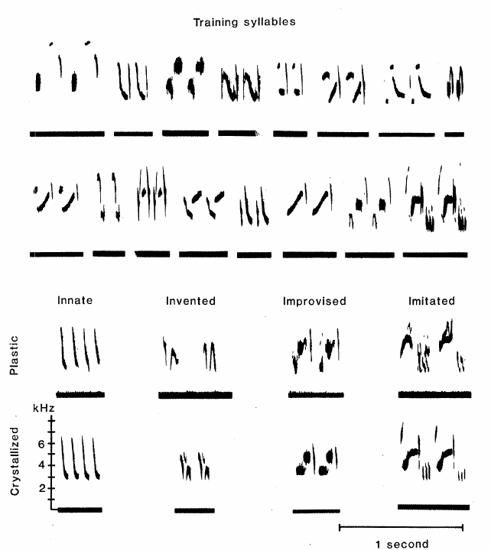
Swamp sparrows reproduce material heard in infancy
Marler and Peters studied swamp sparrows, Melospiza georgiana, reared with controlled recordings in infancy. Later songs contained syllables matching components of those recordings rather than an arbitrary adult pattern. The controlled recordings make the tutor material known in advance.
Training began between 16 and 26 days of age and continued for 40 days. The pupils were then kept in separate soundproof chambers, so they had no continued access to the original acoustic models. Each pupil's infancy recordings and training schedule are recorded in the same way.
Detailed matching after this separation supports storage of song information. The correspondence between later syllables and earlier training material distinguishes learning from independent maturation into a species-typical song. An untrained comparison supplies the baseline for that distinction.
Marler & Peters (1981), Fig. 1. Training syllables and developing vocal material.
Marler & Peters (1981)
18
Notes:
Marler and Peters studied **swamp sparrows**, _Melospiza georgiana_, reared with controlled recordings in infancy. Later songs contained syllables matching components of those recordings rather than an arbitrary adult pattern.
Training began between 16 and 26 days of age and continued for 40 days. The pupils were subsequently kept in separate soundproof chambers, removing continued access to the original acoustic models.
Detailed matching after this separation supports storage of song information. It is the correspondence between the later syllables and earlier training material, together with the untrained comparison, that distinguishes learning from independent maturation into a species-typical song.
The training material contained known syllable arrangements. That controlled history made it possible to compare later vocal units with actual earlier inputs instead of inferring a tutor from resemblance alone.
References:
Marler P, Peters S (1981). Sparrows learn adult song and more from memory. Science 213(4509): 780–782. https://doi.org/10.1126/science.213.4509.780

Slide 24
Swamp sparrows learn from recordings made in infancy
A syllable is a single discrete sound unit in the song. Marler and Peters used recordings whose syllable arrangements were known, which made the tutor material measurable. Each later syllable could then be compared with a specific training syllable, and the arrangement of the syllables in each training recording was known in advance.
Later songs were compared with the training recordings and with an untrained comparison group. The same spectrographic procedure was applied to every bird, which keeps the comparison consistent across pupils. Each training syllable is matched against the later syllables, so the pattern of matches is read directly from the recordings.
A match between a later syllable and a known training syllable supports storage of the training material. That correspondence links the adult song to the infant recordings instead of to a fixed species template. The pattern of matches across many syllables gives a stronger case than any single match.
Marler & Peters (1981), Fig. 1. Training syllables and developing vocal material.
Marler & Peters (1981)
18a
Notes:
Known training syllables make the tutor material measurable.
Syllables.
A syllable is a single discrete sound unit.
Training recordings had known syllable arrangements.
Comparison.
Later songs were compared with the training material.
An untrained group served as the baseline.
Procedure.
The same spectrographic procedure was used for every bird.
Results are comparable across pupils.
Storage.
A match supports storage of the training material.
The adult song links to the infant recordings.
Source values.
The published recordings and measurements come from the original paper.
Each result is reported with the condition used in the source.
Why the measure matters.
The result separates the measured property from the mechanism that produces it.
The comparison stays within the same birds, cells or recordings.
Interpretation.
Each result is read within the preparation and the age group that produced it.
The claim is restricted to the measured birds and conditions.
Context.
The parent figure shows the measurement that the paragraphs describe.
Each claim is tied to the recordings of the original study.
References:
Marler P, Peters S (1981). Sparrows learn adult song and more from memory. Science 213(4509): 780–782. https://doi.org/10.1126/science.213.4509.780

Slide 25
Early subsong does not reproduce the stored syllables
Subsong is variable early singing without the stable syllable organization of mature song. Marler and Peters recorded the pupils repeatedly and classified vocalizations by acoustic stability and organization. Repeated recordings reveal how the early vocal forms change over time.
Early singing lacked recognizable rehearsal of the syllables that would later match the tutor material. Vocal activity in this period therefore did not show continuous practice of each memorized pattern. The early variable vocalizations differ from the later recognizable syllables.
The conclusion rests on repeated recordings and spectrographic comparisons. Those comparisons show a long separation between learning and recognizable imitation, and the same data show that calling both stages singing hides this separation.
Marler & Peters (1981), Fig. 1. Training syllables and developing vocal material.
Marler & Peters (1981)
19
Notes:
**Subsong** is variable early singing without the stable syllable organization of mature song. Marler and Peters recorded the pupils repeatedly and classified vocalizations by acoustic stability and organization.
Early singing lacked recognizable rehearsal of the syllables that would later match the tutor material. The existence of some vocal activity therefore did not establish continuous practice of each memorized pattern.
The conclusion rests on the sampled recordings and spectrographic comparisons. It supports a long separation between learning and recognizable imitation, while avoiding the stronger claim that every possible vocalization throughout the entire interval was observed.
The early variable vocalizations differ from later recognizable syllables. Calling both stages singing does not mean that the same acoustic material was practiced continuously throughout development.
References:
Marler P, Peters S (1981). Sparrows learn adult song and more from memory. Science 213(4509): 780–782. https://doi.org/10.1126/science.213.4509.780

Slide 26
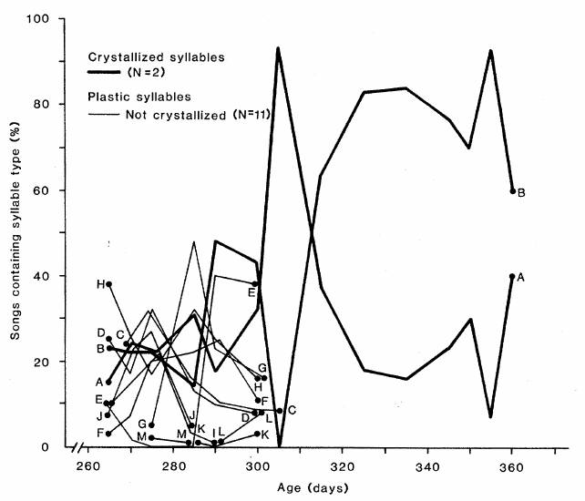
Recognizable rehearsal follows a long retention interval
The swamp sparrows' first recognizable attempts at memorized syllables occurred roughly 225 days after the last training exposure. More definite rehearsal of particular syllables followed about two weeks later. The retention interval lasted about eight months.
That interval is far longer than the immediate delay between hearing and repeating a sound. The birds began regular song development near adulthood, rather than producing a mature copy during infancy. Perceptual memory from training therefore persisted through the whole interval.
The result supports long-lasting perceptual memory that guides later motor learning. The same memory can be used long after the original exposure ended, which places its use at the start of adult singing. Stable retention across the swamp sparrows supports the same conclusion for each pupil.
Marler & Peters (1981), Fig. 2. Syllable use across developmental age.
Marler & Peters (1981)
20
Notes:
The swamp sparrows' first recognizable attempts at memorized syllables occurred roughly 225 days after the last training exposure. More definite rehearsal of particular syllables followed about two weeks later.
The interval was approximately eight months, far longer than the immediate delay between hearing and repeating a sound. The birds began regular song development near adulthood rather than producing a mature copy during infancy.
This result supports long-lasting perceptual memory that can guide later motor learning. The retention interval does not itself identify the molecular substrate of memory, nor establish that a template must be stored in a single brain nucleus.
References:
Marler P, Peters S (1981). Sparrows learn adult song and more from memory. Science 213(4509): 780–782. https://doi.org/10.1126/science.213.4509.780

Slide 27
Crystallization stabilizes previously variable syllables
Plastic song holds developing syllables whose form or combination still varies. Crystallization marks the shift to a stable mature pattern, which Marler and Peters identified with repeated spectrographic analysis. Each syllable's stability is judged by its repeated form.
Mature swamp sparrow songs consisted of a roughly two-second series of repeated multinote syllables. Defined syllables and regular repetition emerged from earlier, less organized vocalizations. Each adult pattern can be traced back to specific plastic-song forms.
The transition involved refinement and stabilization of material already present during development. Longitudinal recordings therefore separate acquisition from the final expression of a repertoire. Stability was judged across repeated renditions, so one well-formed syllable in plastic song marks crystallization only when it repeats reliably.
Marler & Peters (1981), Fig. 1. Training syllables and developing vocal material.
Marler & Peters (1981)
21
Notes:
**Plastic song** contains developing syllables whose acoustic form or combination remains variable. **Crystallization** is the transition to the more stable mature song pattern. Marler and Peters distinguished these states through repeated spectrographic analysis.
Mature swamp sparrow songs consisted of a roughly two-second series of repeated multinote syllables. Defined syllables and regular repetition emerged from earlier, less organized vocalizations.
The transition was not the first occurrence of every adult sound. It involved refinement and stabilization of material already present during development, making longitudinal recordings necessary for distinguishing acquisition from the final expression of a repertoire.
Stability was assessed across repeated renditions. A single well-formed syllable during plastic song therefore did not by itself establish that the adult pattern had crystallized.
References:
Marler P, Peters S (1981). Sparrows learn adult song and more from memory. Science 213(4509): 780–782. https://doi.org/10.1126/science.213.4509.780

Slide 28
Plastic syllables are refined into stable adult song
Syllable stability is the consistency of a syllable's form across repeated renditions. Marler and Peters judged stability by comparing renditions over time, so a syllable counts as stable only when it recurs in a consistent form. Each syllable's history is followed from its first appearance to its final form.
Crystallization narrows the repertoire to syllables that recur reliably. Mature songs contained defined syllables that emerged from earlier, less organized vocalizations, and those forms can be traced through the recordings. Each adult syllable has a traceable history in the plastic song that preceded it.
Longitudinal recordings show how the plastic repertoire becomes the adult repertoire. The transition uses material already present in development, so the adult song reflects refinement of earlier forms. Each bird's recordings across ages show the same gradual narrowing from many variable forms to a stable set.
Marler & Peters (1981), Fig. 1. Training syllables and developing vocal material.
Marler & Peters (1981)
21a
Notes:
Stability is judged across repeated renditions.
Stability.
A syllable is stable when its form recurs consistently.
Single renditions are not enough.
Crystallization.
The repertoire narrows to reliable syllables.
Mature songs contain defined syllables.
Origin.
Adult syllables emerged from plastic-song forms.
The forms can be traced through recordings.
Refinement.
Adult song refines material already present.
The change is gradual rather than sudden.
Source values.
The published recordings and measurements come from the original paper.
Each result is reported with the condition used in the source.
Why the measure matters.
The result separates the measured property from the mechanism that produces it.
The comparison stays within the same birds, cells or recordings.
Interpretation.
Each result is read within the preparation and the age group that produced it.
The claim is restricted to the measured birds and conditions.
Context.
The parent figure shows the measurement that the paragraphs describe.
Each claim is tied to the recordings of the original study.
References:
Marler P, Peters S (1981). Sparrows learn adult song and more from memory. Science 213(4509): 780–782. https://doi.org/10.1126/science.213.4509.780

Slide 29
Plastic song contains material absent from adult song
A repertoire is the collection of distinct song types or syllables produced by an individual. During plastic song, swamp sparrows produced more distinct syllables than remained in their crystallized adult repertoires. Their developmental song therefore held more material than the adult song.
Marler and Peters tracked individual syllable types across age. Some copied training syllables were expressed temporarily and then disappeared, alongside other developing material. Each named syllable type was followed through its changing use. The developmental record makes each copied syllable's pattern of use visible.
Adult song therefore underestimates the information revealed during learning. A developmental record detects temporary expression that a single adult recording would miss. Copied syllables that appear and later drop out still show learning at the time they were sung.
Marler & Peters (1981), Fig. 2. Syllable use across developmental age.
Marler & Peters (1981)
22
Notes:
A **repertoire** is the collection of distinct song types or syllables produced by an individual. During plastic song, swamp sparrows produced more distinct syllables than remained in their crystallized adult repertoires.
Marler and Peters tracked individual syllable types across age. Some copied training syllables were expressed temporarily and then disappeared, alongside other developing material.
Adult song therefore underestimates information revealed during learning. Failure to retain a copied syllable in the final repertoire does not establish failure to learn it; a developmental record can detect temporary expression that a single adult recording would miss.
The age record followed named syllable types as their use changed. A copied type could be temporarily expressed and later lost while other copied material remained in the adult repertoire.
References:
Marler P, Peters S (1981). Sparrows learn adult song and more from memory. Science 213(4509): 780–782. https://doi.org/10.1126/science.213.4509.780

Slide 30
Imitation, improvisation, and invention contribute to song
Marler and Peters classified developing swamp sparrow syllables by their relation to the training recordings. Imitations matched models, improvisations resembled altered or poorly copied models, and inventions had no identified model in the training set. Each syllable received one of the three labels.
These categories occurred together during plastic song, and both copied and noncopied syllables could be discarded during crystallization. Adult development therefore involved selection as well as acoustic refinement. The reduction acted on every category.
The classification depends on comparison with the known recordings. Labeling a syllable an invention sets its category by the absence of a matching model. Copied and invented material mingled during plastic song, and the reduction at crystallization acted on both.
Marler & Peters (1981), Fig. 1. Training syllables and developing vocal material.
Marler & Peters (1981)
23
Notes:
Marler and Peters classified developing swamp sparrow syllables by their relation to the training recordings. **Imitations** matched models; **improvisations** resembled altered or poorly copied models; **inventions** lacked an identified model in the training set.
These categories occurred together during plastic song, and both copied and noncopied syllables could be discarded during crystallization. Adult development involved selection as well as acoustic refinement.
The classification depends on comparison with the known recordings. It does not establish a new neural mechanism for each category, and an unrecognized copy cannot be excluded merely by labeling a syllable an invention.
Copied and invented material mingled during plastic song. The reduction at crystallization therefore acted on both categories, rather than selectively retaining every syllable that matched the tutor.
References:
Marler P, Peters S (1981). Sparrows learn adult song and more from memory. Science 213(4509): 780–782. https://doi.org/10.1126/science.213.4509.780

Slide 31
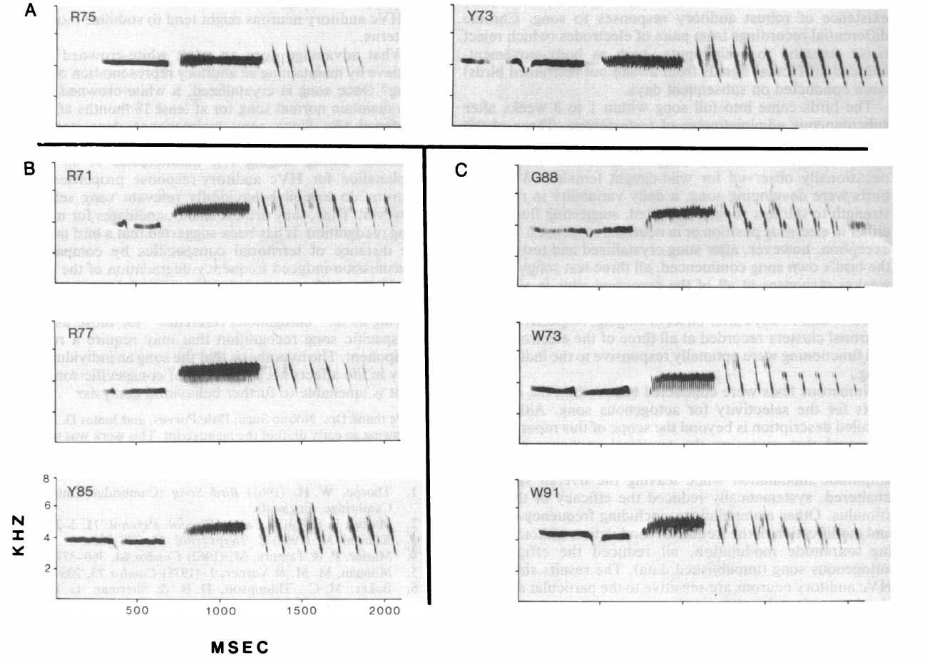
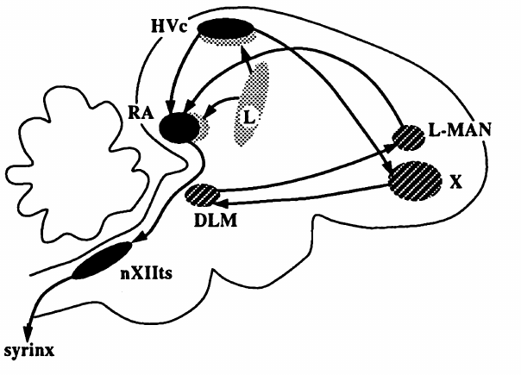
Own song can be distinguished from the tutor song
Autogenous song is the song produced by the individual itself. Margoliash and Konishi compared auditory responses in adult white-crowned sparrows to own song, other dialect songs and a training model. Each stimulus came from a separate recording. The bird's own song and the tutor's song are both included among these stimuli.
Their comparisons included laboratory-reared birds whose final songs differed from the model they had heard. A tutor recording and the bird's own vocal output were therefore separable acoustic stimuli. The two sounds could be compared directly. Their final songs were checked against the model in every bird.
This distinction matters for interpreting a possible template. A neuron preferring own song is a neuron responding to the bird's output, and the stored tutor target is a separate question. The copied model and the resulting vocalization can share many features while remaining acoustically different.
Doupe & Konishi (1991), Fig. 1. Published anatomical locations and pathways.
Margoliash & Konishi (1985), Fig. 2. Own-song and same-dialect comparison spectrograms.
Margoliash & Konishi (1985)
24
Notes:
**Autogenous song** means the song produced by the individual itself. Margoliash and Konishi compared auditory responses in adult white-crowned sparrows to own song, other dialect songs, and a training model.
Their comparisons included laboratory-reared birds whose final songs differed from the model they had heard. A tutor recording and the bird's own vocal output were therefore separable acoustic stimuli.
This distinction is essential for interpreting a possible template. A neuron preferring own song is not automatically a neuron storing the tutor target, because the copied model and the resulting vocalization can share many features yet remain acoustically different.
The tutor is the acoustic source of the training model. Own song is the pupil’s resulting output; the distinction persists even when their shared features make them superficially similar.
References:
Margoliash D, Konishi M (1985). Auditory representation of autogenous song in the song system of white-crowned sparrows. Proceedings of the National Academy of Sciences USA 82(17): 5997–6000. https://doi.org/10.1073/pnas.82.17.5997
Doupe AJ, Konishi M (1991). Song-selective auditory circuits in the vocal control system of the zebra finch. Proceedings of the National Academy of Sciences USA 88(24): 11339–11343. https://doi.org/10.1073/pnas.88.24.11339

Slide 32
Own song and the tutor model are separable stimuli
Playback stimuli are recordings presented to a bird while its neural responses are measured. Margoliash and Konishi used own-song recordings, dialect songs and a training model as separate stimuli, so each source can be compared directly.
Birds reared in the laboratory produced final songs that differed from the model they had heard. Their own song and the tutor recording therefore remained separable acoustic stimuli. Each bird's song was compared with its own training model, so the comparison is specific to the individual.
A neuron that prefers own song responds to the bird's output rather than to the tutor target. Keeping the two stimuli separate allows the study to test each one on its own terms. Each response is assigned to the stimulus that produced it, so the two responses can be compared directly.
Doupe & Konishi (1991), Fig. 1. Published anatomical locations and pathways.
Margoliash & Konishi (1985), Fig. 2. Own-song and same-dialect comparison spectrograms.
Margoliash & Konishi (1985)
24a
Notes:
Playback stimuli are kept separate in the comparison.
Stimuli.
Own song, dialect songs and a training model were tested.
Each was a separate recording.
Laboratory birds.
Final songs differed from the model heard.
Own song and the tutor recording stayed distinct.
Preference.
A preference for own song reflects the bird's output.
It is not the same as the tutor target.
Design.
Separate stimuli allow each to be tested on its own terms.
The comparison stays clear.
Source values.
The published recordings and measurements come from the original paper.
Each result is reported with the condition used in the source.
Why the measure matters.
The result separates the measured property from the mechanism that produces it.
The comparison stays within the same birds, cells or recordings.
Interpretation.
Each result is read within the preparation and the age group that produced it.
The claim is restricted to the measured birds and conditions.
Context.
The parent figure shows the measurement that the paragraphs describe.
Each claim is tied to the recordings of the original study.
References:
Margoliash D, Konishi M (1985). Auditory representation of autogenous song in the song system of white-crowned sparrows. Proceedings of the National Academy of Sciences USA 82(17): 5997–6000. https://doi.org/10.1073/pnas.82.17.5997

Slide 33
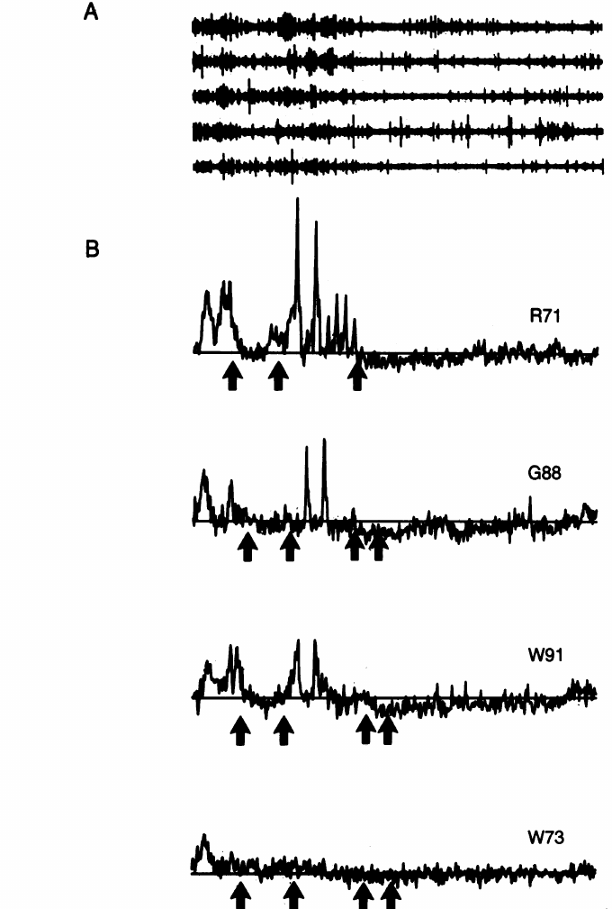
HVC responds strongly to playback of own song
HVC is a forebrain song nucleus involved in learned vocal control. In Margoliash and Konishi's adult sparrow recordings, playback of the bird's own song elicited strong responses from song-responsive neuronal clusters. Those responses were measured at the same recording sites as the comparison songs.
An amplitude-derived measure quantified the multiunit signal, which pools activity from several nearby neurons. The study compared own-song responses with responses to other songs at each site using controlled presentations. The comparison keeps the recording site constant.
The larger own-song response establishes auditory selectivity in this preparation. Playback responsiveness and an active feedback comparison are separate physiological measurements, and this experiment measures the first. Every comparison uses the same neuronal cluster, so stimulus differences are not confounded with recording-site differences.
Doupe & Konishi (1991), Fig. 1. Published anatomical locations and pathways.
Margoliash & Konishi (1985), Fig. 1. Multiunit responses to own and comparison songs.
Margoliash & Konishi (1985)
25
Notes:
**HVC** is a forebrain song nucleus involved in learned vocal control. In Margoliash and Konishi's adult sparrow recordings, playback of the bird's own song elicited strong responses from song-responsive neuronal clusters.
The study compared these responses with responses to other songs using the same recording site and controlled presentations. An amplitude-derived measure quantified the multiunit signal, which pools activity from several nearby neurons.
The larger own-song response establishes auditory selectivity in this preparation. It does not establish that the same clusters compute error during singing, because playback responsiveness and an active feedback comparison are different physiological measurements.
Own song and the alternative recordings were compared at the same neuronal cluster. This control avoids attributing a stimulus difference to measurements from unrelated recording sites.
References:
Margoliash D, Konishi M (1985). Auditory representation of autogenous song in the song system of white-crowned sparrows. Proceedings of the National Academy of Sciences USA 82(17): 5997–6000. https://doi.org/10.1073/pnas.82.17.5997
Doupe AJ, Konishi M (1991). Song-selective auditory circuits in the vocal control system of the zebra finch. Proceedings of the National Academy of Sciences USA 88(24): 11339–11343. https://doi.org/10.1073/pnas.88.24.11339

Slide 34
Same-dialect songs remain distinguishable in HVC
Songs from the same dialect share conspicuous structural features, which makes them a demanding comparison for own-song selectivity. Margoliash and Konishi tested own song against other songs from the Bodega Bay dialect. The alternatives came from the same local tradition as the tested birds.
The bird's own song generally elicited stronger multiunit responses even when the alternatives belonged to the same local acoustic tradition. Selectivity therefore extended beyond a simple distinction between two geographically different dialects. Individual song structure was sufficient to drive the difference.
The experiment supports sensitivity to individual song structure. Neuronal responses to recordings are measured here, and the animal's behavioral discrimination of its singer is a separate measure. Differences arose despite common dialect structure, so the shared features did not erase the response.
Doupe & Konishi (1991), Fig. 1. Published anatomical locations and pathways.
Margoliash & Konishi (1985), Fig. 2. Own-song and same-dialect comparison spectrograms.
Margoliash & Konishi (1985)
26
Notes:
Songs from the same dialect share conspicuous structural features, making them a demanding comparison for own-song selectivity. Margoliash and Konishi tested own song against other songs from the Bodega Bay dialect.
The bird's own song generally elicited stronger multiunit responses even when the alternatives belonged to the same local acoustic tradition. Selectivity therefore extended beyond a simple distinction between two geographically different dialects.
The experiment supports sensitivity to individual song structure. It does not demonstrate behavioral recognition of the singer, because neuronal responses to recordings and the animal's discrimination or social response must be tested separately.
The alternatives shared the Bodega Bay dialect with the tested singers. Differences in response thus occurred despite common dialect structure, not only when the playback belonged to another population.
References:
Margoliash D, Konishi M (1985). Auditory representation of autogenous song in the song system of white-crowned sparrows. Proceedings of the National Academy of Sciences USA 82(17): 5997–6000. https://doi.org/10.1073/pnas.82.17.5997
Doupe AJ, Konishi M (1991). Song-selective auditory circuits in the vocal control system of the zebra finch. Proceedings of the National Academy of Sciences USA 88(24): 11339–11343. https://doi.org/10.1073/pnas.88.24.11339

Slide 35
Unusual learned sounds can acquire selective responses
Laboratory birds in Margoliash and Konishi's study produced unusual song components, including patterns absent from the natural songs used for comparison. Their neural responses still favored their own vocalizations. The abnormal components were part of each bird's own output.
These cases argue against an explanation based only on a fixed preference for the normal species song. HVC responses can be associated with an individual's acquired or self-produced acoustic pattern, including abnormal components. Learned sound can therefore shape the response.
Experience-dependent tuning is consistent with this result. The adult comparison combines tutor exposure with auditory feedback of the bird's own singing, so both histories contribute to the link between vocal output and neural selectivity. The training paradigm included an unnatural upward-sweeping trill, and responses to it favored the bird's own abnormal components.
Doupe & Konishi (1991), Fig. 1. Published anatomical locations and pathways.
Margoliash & Konishi (1985), Fig. 2. Own-song and same-dialect comparison spectrograms.
Margoliash & Konishi (1985)
27
Notes:
Laboratory birds in Margoliash and Konishi's study produced unusual song components, including patterns absent from the natural songs used for comparison. Their neural responses still favored their own vocalizations.
These cases weaken an explanation based only on a fixed preference for the normal species song. HVC responses could be associated with an individual's acquired or self-produced acoustic pattern, including abnormal components.
Experience-dependent tuning is consistent with this result, but the adult comparison does not isolate tutor exposure from auditory feedback of the bird's own singing. Both histories can contribute to the correspondence between vocal output and neural selectivity.
The training paradigm included an unnatural upward-sweeping trill. Selective responses to abnormal own-song components weaken a purely fixed preference for the acoustic details normally heard in wild songs.
References:
Margoliash D, Konishi M (1985). Auditory representation of autogenous song in the song system of white-crowned sparrows. Proceedings of the National Academy of Sciences USA 82(17): 5997–6000. https://doi.org/10.1073/pnas.82.17.5997
Doupe AJ, Konishi M (1991). Song-selective auditory circuits in the vocal control system of the zebra finch. Proceedings of the National Academy of Sciences USA 88(24): 11339–11343. https://doi.org/10.1073/pnas.88.24.11339

Slide 36
Learned abnormal sound shapes HVC selectivity
Abnormal song components are unusual sounds produced by a bird that differ from the natural species song. In this study, the laboratory birds' unusual components were absent from the natural songs used for comparison. Those components came from each bird's own training history, so they reflect what the bird learned.
Their HVC responses still favored their own vocalizations. A response that follows the bird's own abnormal pattern indicates that selectivity can track acquired acoustic material. This result holds for the abnormal components themselves, not only for the normal song features the birds shared with other singers.
The training included an unnatural upward-sweeping trill. Selectivity for the bird's own abnormal components therefore shows how experience can shape the neural response. The same comparison set against natural songs makes the role of experience clear.
Doupe & Konishi (1991), Fig. 1. Published anatomical locations and pathways.
Margoliash & Konishi (1985), Fig. 2. Own-song and same-dialect comparison spectrograms.
Margoliash & Konishi (1985)
27a
Notes:
Abnormal learned sounds can acquire selective responses.
Components.
The birds produced unusual song components.
These were absent from the natural comparison songs.
Responses.
HVC responses favored the bird's own vocalizations.
The preference followed the abnormal pattern.
Training.
The paradigm included an upward-sweeping trill.
The trill was unnatural for the species.
Meaning.
Experience can shape neural selectivity.
Acquired acoustic material can drive the response.
Source values.
The published recordings and measurements come from the original paper.
Each result is reported with the condition used in the source.
Why the measure matters.
The result separates the measured property from the mechanism that produces it.
The comparison stays within the same birds, cells or recordings.
Interpretation.
Each result is read within the preparation and the age group that produced it.
The claim is restricted to the measured birds and conditions.
Context.
The parent figure shows the measurement that the paragraphs describe.
Each claim is tied to the recordings of the original study.
References:
Margoliash D, Konishi M (1985). Auditory representation of autogenous song in the song system of white-crowned sparrows. Proceedings of the National Academy of Sciences USA 82(17): 5997–6000. https://doi.org/10.1073/pnas.82.17.5997

Slide 37
An auditory preference does not locate the tutor memory
A stronger response to own song supplies a candidate representation of vocal output. That response marks the bird's own output as a stimulus, while the remembered target that guides a pupil toward its tutor's song requires a separate measure.
Margoliash and Konishi's comparisons separated own-song preference from general dialect responsiveness. Their adult recordings characterized stimulus selectivity in the mature bird. Each measure is kept separate in the analysis to show what it captures.
Evidence linking a representation to learning strengthens a template hypothesis. Correlation between a neuron's preferred stimulus and the mature song supports a candidate role. A demonstrated teaching target would come from measurements or interventions that connect the representation to acquisition and correction.
Doupe & Konishi (1991), Fig. 1. Published anatomical locations and pathways.
Margoliash & Konishi (1985), Fig. 1. Multiunit responses to own and comparison songs.
Margoliash & Konishi (1985)
28
Notes:
A stronger response to own song supplies a possible representation of vocal output. It does not, by itself, identify the remembered target used to guide a pupil toward its tutor's song.
Margoliash and Konishi's comparisons separated own-song preference from general dialect responsiveness. Their adult recordings characterized stimulus selectivity rather than directly observing formation or retrieval of the early tutor memory.
A template hypothesis requires additional evidence linking a representation to learning. Correlation between a neuron's preferred stimulus and the mature song supports a candidate role, while a demonstrated teaching target would require measurements or interventions that connect it to acquisition and correction.
References:
Margoliash D, Konishi M (1985). Auditory representation of autogenous song in the song system of white-crowned sparrows. Proceedings of the National Academy of Sciences USA 82(17): 5997–6000. https://doi.org/10.1073/pnas.82.17.5997
Doupe AJ, Konishi M (1991). Song-selective auditory circuits in the vocal control system of the zebra finch. Proceedings of the National Academy of Sciences USA 88(24): 11339–11343. https://doi.org/10.1073/pnas.88.24.11339

Slide 38
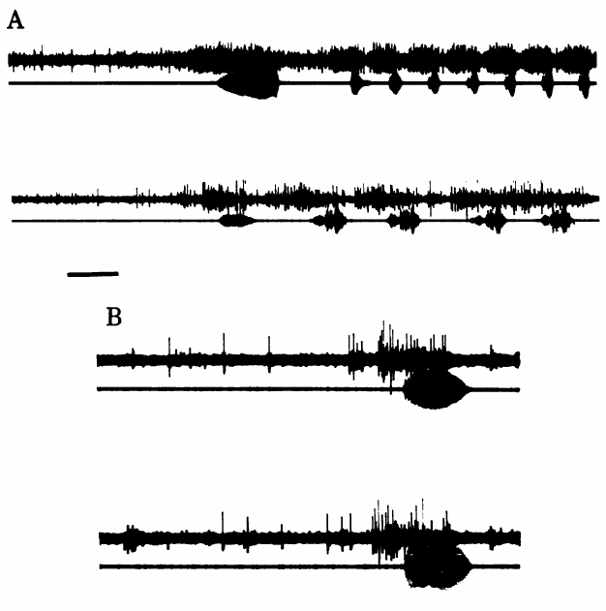
HVC activity is timed to the bird’s own singing
McCasland and Konishi implanted electrodes and recorded vocal output together with neural activity in freely moving birds. The experiment sampled canaries, white-crowned sparrows and zebra finches. Joint recording lines up the two signals on one time base.
Activity within HVC increased in temporal correspondence with song elements. Control recordings outside the nucleus showed no comparable song-locked changes. Postoperative songs were checked against recordings made before implantation. Each burst is compared with the timing of the bird's own song.
These measurements connect HVC to the timing of vocal performance. Extracellular multiunit recordings combine signals from nearby cells, so each burst reflects a pooled population. Songs recorded after implantation matched preoperative songs, which confirms that the procedure left the vocal pattern intact.
Doupe & Konishi (1991), Fig. 1. Published anatomical locations and pathways.
McCasland & Konishi (1981), Fig. 1. HVC discharge during vocal production.
McCasland & Konishi (1981)
29
Notes:
McCasland and Konishi implanted electrodes and recorded vocal output together with neural activity in freely moving birds. The experiment sampled canaries, white-crowned sparrows, and zebra finches.
Activity within HVC increased in temporal correspondence with song elements. Control recordings outside the nucleus lacked comparable song-locked changes, and postoperative songs were checked against recordings made before implantation.
These measurements connect HVC to the timing of vocal performance. Because extracellular multiunit recordings combine signals from nearby cells, they do not specify the role of every neuron or establish that each observed burst generates the corresponding sound element.
Songs recorded after electrode implantation were compared with preoperative songs. This check reduced an explanation in which the recording procedure itself created the abnormal vocal pattern under measurement.
References:
McCasland JS, Konishi M (1981). Interaction between auditory and motor activities in an avian song control nucleus. Proceedings of the National Academy of Sciences USA 78(12): 7815–7819. https://doi.org/10.1073/pnas.78.12.7815
Doupe AJ, Konishi M (1991). Song-selective auditory circuits in the vocal control system of the zebra finch. Proceedings of the National Academy of Sciences USA 88(24): 11339–11343. https://doi.org/10.1073/pnas.88.24.11339

Slide 39
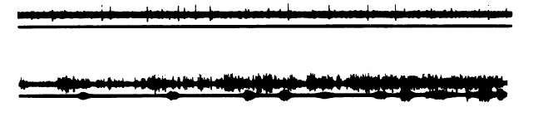
Song-related discharge persists without hearing
McCasland and Konishi compared song-associated HVC activity before and after deafening by removal of the cochlea, the inner-ear organ required for hearing. Song-related discharge remained in the deafened bird. The cochlea removal leaves the motor-timed activity in view.
Persistence of that temporal pattern shows the signal was not simply an auditory response driven by the sound of each produced syllable. A motor-associated component occurs when normal acoustic feedback is absent. The discharge therefore reflects ongoing neural activity.
The result separates ongoing neural activity from immediate hearing. Auditory feedback shapes normal development and long-term maintenance, and the origin of a discharge is a distinct question from the plasticity of learned song. Each question is answered by its own experiment.
Doupe & Konishi (1991), Fig. 1. Published anatomical locations and pathways.
McCasland & Konishi (1981), Fig. 2. Song-related discharge after deafening.
McCasland & Konishi (1981)
30
Notes:
McCasland and Konishi compared song-associated HVC activity before and after deafening by removal of the cochlea, the inner-ear organ required for hearing. Song-related discharge remained in the deafened bird.
Persistence of that temporal pattern means the signal was not simply an auditory response driven by the sound of each produced syllable. A motor-associated component could occur when normal acoustic feedback was absent.
The result separates ongoing neural activity from immediate hearing. It does not imply that auditory feedback is unnecessary for normal development or long-term maintenance; the origin of a discharge and the plasticity of learned song are distinct questions.
References:
McCasland JS, Konishi M (1981). Interaction between auditory and motor activities in an avian song control nucleus. Proceedings of the National Academy of Sciences USA 78(12): 7815–7819. https://doi.org/10.1073/pnas.78.12.7815
Doupe AJ, Konishi M (1991). Song-selective auditory circuits in the vocal control system of the zebra finch. Proceedings of the National Academy of Sciences USA 88(24): 11339–11343. https://doi.org/10.1073/pnas.88.24.11339

Slide 40
Deafening leaves song-timed HVC activity intact
A deafened bird has had its cochlea removed, so it no longer hears its own song. McCasland and Konishi recorded HVC activity in such birds during singing to separate auditory input from the motor timing of song. Each recording was matched to the bird's own vocal output.
Song-related HVC activity continued after deafening. The temporal pattern matched the song's elements, which indicates that the discharge was not driven by hearing each syllable. The persistence of this pattern in the absence of hearing is the key observation.
Recording before and after deafening holds the bird's song and electrode placement constant. The comparison attributes the persistent pattern to the nucleus's own activity during singing. This control identifies the nucleus rather than the sound as the source of the timed discharge.
Doupe & Konishi (1991), Fig. 1. Published anatomical locations and pathways.
McCasland & Konishi (1981), Fig. 2. Song-related discharge after deafening.
McCasland & Konishi (1981)
30a
Notes:
Song-timed HVC activity persists after deafening.
Deafening.
The cochlea was removed in the deafened bird.
Hearing of the bird's own song was lost.
Discharge.
Song-related discharge continued after deafening.
Its timing matched the song's elements.
Comparison.
Recordings were made before and after deafening.
The song and electrode placement stayed constant.
Meaning.
The persistent pattern reflects the nucleus's own activity.
It is not a direct echo of each syllable's sound.
Source values.
The published recordings and measurements come from the original paper.
Each result is reported with the condition used in the source.
Why the measure matters.
The result separates the measured property from the mechanism that produces it.
The comparison stays within the same birds, cells or recordings.
Interpretation.
Each result is read within the preparation and the age group that produced it.
The claim is restricted to the measured birds and conditions.
Context.
The parent figure shows the measurement that the paragraphs describe.
Each claim is tied to the recordings of the original study.
References:
McCasland JS, Konishi M (1981). Interaction between auditory and motor activities in an avian song control nucleus. Proceedings of the National Academy of Sciences USA 78(12): 7815–7819. https://doi.org/10.1073/pnas.78.12.7815

Slide 41
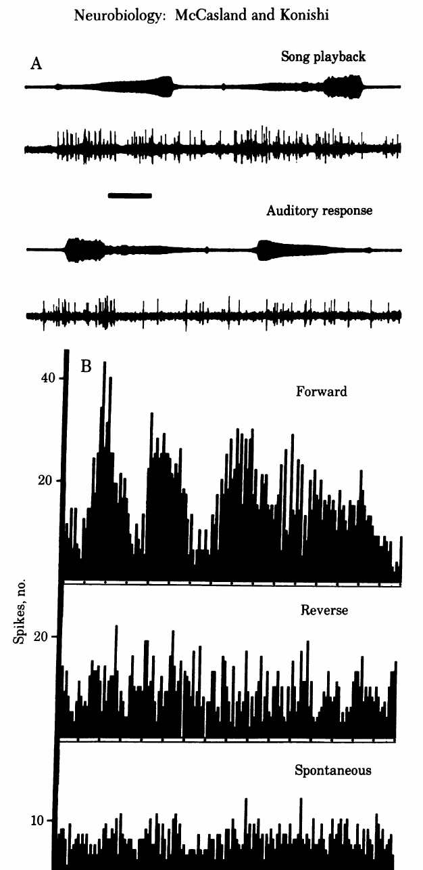
Reversed playback changes the auditory response
A recording can be played forward or reversed while neural activity is measured in a bird that is not singing. McCasland and Konishi found different HVC responses to these versions of song. The forward and reversed versions share the same recorded material.
Reversal changes the temporal organization of the acoustic signal. The comparison tests whether responses depend on more than the presence of sound energy within a similar overall frequency range. The response therefore reflects temporal sensitivity.
A forward preference supports temporal sensitivity in the auditory response. Reversing a waveform changes both the order of elements and their internal acoustic progression, so the preference captures temporal structure as a whole. The arrangement of the same recorded material produces the response difference.
Doupe & Konishi (1991), Fig. 1. Published anatomical locations and pathways.
McCasland & Konishi (1981), Fig. 3. Forward and reverse playback responses.
McCasland & Konishi (1981)
31
Notes:
A recording can be played forward or reversed while neural activity is measured in a bird that is not singing. McCasland and Konishi found different HVC responses to these versions of song.
Reversal changes the temporal organization of the acoustic signal. The comparison tests whether responses depend on more than the presence of sound energy within a similar overall frequency range.
A forward preference supports temporal sensitivity in the auditory response. It does not isolate a single temporal feature, because reversing a waveform changes both the order of elements and their internal acoustic progression.
A forward and reverse comparison changes the arrangement of the same recorded material. The resulting response difference cannot be explained simply by replacing the stimulus with another singer’s song.
References:
McCasland JS, Konishi M (1981). Interaction between auditory and motor activities in an avian song control nucleus. Proceedings of the National Academy of Sciences USA 78(12): 7815–7819. https://doi.org/10.1073/pnas.78.12.7815
Doupe AJ, Konishi M (1991). Song-selective auditory circuits in the vocal control system of the zebra finch. Proceedings of the National Academy of Sciences USA 88(24): 11339–11343. https://doi.org/10.1073/pnas.88.24.11339

Slide 42
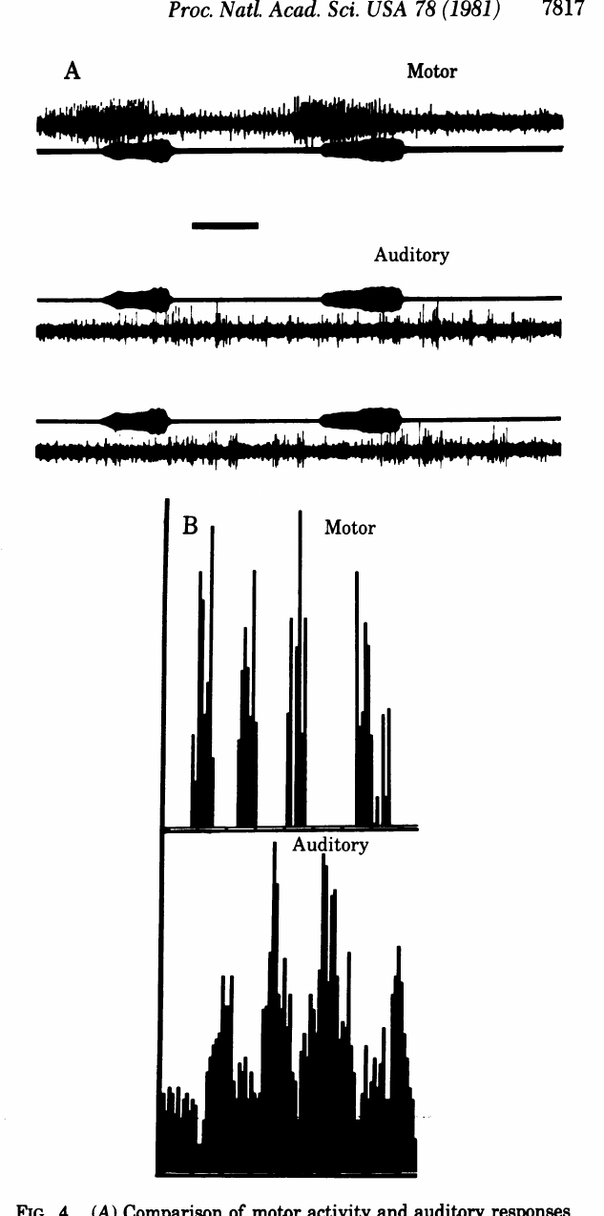
Playback and singing evoke distinguishable activity patterns
McCasland and Konishi compared activity recorded during singing with auditory responses to playback of the same song elements. The two sets of discharge patterns differed in their timing. Both measures use the same song elements, which keeps the comparison matched.
This comparison holds much of the acoustic content constant while changing whether the bird produces the song. The recordings therefore implicate behavioral context and motor-associated activity in the measured response. Similar sound content produces different neural activity during listening and active production.
The result argues against treating every song-related HVC discharge as a passive response to hearing. The recordings characterize multiunit activity, which pools several neurons, and the acoustic recording gives a shared reference for aligning the two response patterns.
Doupe & Konishi (1991), Fig. 1. Published anatomical locations and pathways.
McCasland & Konishi (1981), Fig. 4. Motor and auditory discharge patterns.
McCasland & Konishi (1981)
32
Notes:
McCasland and Konishi compared activity recorded during singing with auditory responses to playback of the same song elements. The temporal discharge patterns were distinguishable rather than identical.
This comparison holds much of the acoustic content constant while changing whether the bird is producing the song. The recordings therefore implicate behavioral context and motor-associated activity in the measured response.
The result argues against treating every song-related HVC discharge as a passive response to hearing. It does not establish how an individual cell combines sensory and motor inputs, because the recordings characterize multiunit activity rather than a complete identified synaptic circuit.
The acoustic recording supplies a shared reference for aligning the two response patterns. Similar sound content therefore need not produce identical neural activity during listening and active production.
References:
McCasland JS, Konishi M (1981). Interaction between auditory and motor activities in an avian song control nucleus. Proceedings of the National Academy of Sciences USA 78(12): 7815–7819. https://doi.org/10.1073/pnas.78.12.7815
Doupe AJ, Konishi M (1991). Song-selective auditory circuits in the vocal control system of the zebra finch. Proceedings of the National Academy of Sciences USA 88(24): 11339–11343. https://doi.org/10.1073/pnas.88.24.11339

Slide 43
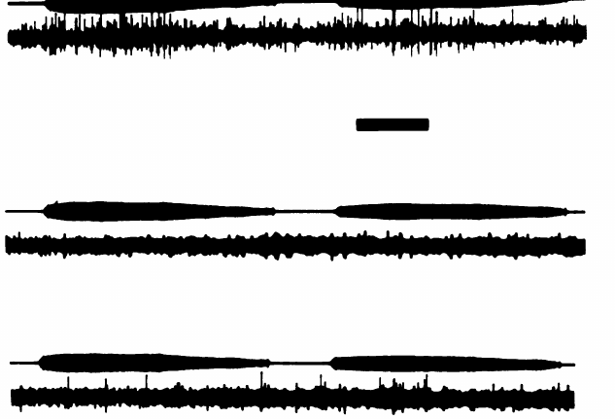
Auditory responsiveness is suppressed around singing
Playback during and after singing revealed a reduction in HVC auditory responses associated with vocal production. McCasland and Konishi described suppression that decayed over seconds after the song ended. The suppression therefore follows the bird's vocal behavior.
The suppression follows the bird's own vocal behavior rather than a continuous auditory response to each emitted sound. Vocal behavior changed the conditions under which a playback stimulus evoked activity. The timing of the decay is measured at each point after the song.
Gating is a change in access or responsiveness to sensory input associated with behavioral state. This observation adds state dependence to the picture of a feedback comparator, since responses to playback depend on what the bird has just done. Suppression persisted after the song ended and then recovered.
Doupe & Konishi (1991), Fig. 1. Published anatomical locations and pathways.
McCasland & Konishi (1981), Fig. 5. Suppression of auditory responses around singing.
McCasland & Konishi (1981)
33
Notes:
Playback during and after singing revealed a reduction in HVC auditory responses associated with vocal production. McCasland and Konishi described suppression that decayed over seconds after the song ended.
The same suppression was not explained by a simple continuous auditory response to every emitted sound. Vocal behavior changed the conditions under which a playback stimulus could evoke activity.
**Gating** is a change in access or responsiveness to sensory input associated with behavioral state. This observation complicates a passive feedback-comparator account; a circuit's response to playback in a silent bird cannot simply be assumed to describe its operation during singing.
Suppression persisted after the song terminated and then recovered. Its time course links auditory responsiveness to the preceding vocal behavior instead of merely the instantaneous presence of an acoustic stimulus.
References:
McCasland JS, Konishi M (1981). Interaction between auditory and motor activities in an avian song control nucleus. Proceedings of the National Academy of Sciences USA 78(12): 7815–7819. https://doi.org/10.1073/pnas.78.12.7815
Doupe AJ, Konishi M (1991). Song-selective auditory circuits in the vocal control system of the zebra finch. Proceedings of the National Academy of Sciences USA 88(24): 11339–11343. https://doi.org/10.1073/pnas.88.24.11339

Slide 44
Suppression of responses follows vocal behavior
Auditory suppression is a temporary reduction in the response to sound. McCasland and Konishi measured it in HVC during and after singing, when a playback stimulus was presented. The stimulus was the same in each condition, which isolates the effect of the bird's own vocal behavior.
The suppression decayed over seconds after the song ended, which links its time course to the preceding vocal behavior. A simple response to each sound would instead follow the stimulus itself, rising and falling with the playback. The gradual recovery is the signature of a state rather than a stimulus.
This timing shows that auditory responsiveness depends on what the bird has just produced. A recovery curve after singing therefore reveals the state of the nucleus as well as the sound. The same measurement can be repeated at several delays to map how the suppression changes over time.
Doupe & Konishi (1991), Fig. 1. Published anatomical locations and pathways.
McCasland & Konishi (1981), Fig. 5. Suppression of auditory responses around singing.
McCasland & Konishi (1981)
33a
Notes:
Auditory responses are suppressed around singing.
Suppression.
A temporary reduction in the response to playback.
It was measured during and after singing.
Time course.
The suppression decayed over seconds.
Recovery followed the end of the song.
Comparison.
A simple response would follow the stimulus.
Here the response follows the bird's behavior.
Meaning.
Auditory responsiveness depends on vocal state.
Recovery reveals the state of the nucleus.
Source values.
The published recordings and measurements come from the original paper.
Each result is reported with the condition used in the source.
Why the measure matters.
The result separates the measured property from the mechanism that produces it.
The comparison stays within the same birds, cells or recordings.
Interpretation.
Each result is read within the preparation and the age group that produced it.
The claim is restricted to the measured birds and conditions.
Context.
The parent figure shows the measurement that the paragraphs describe.
Each claim is tied to the recordings of the original study.
References:
McCasland JS, Konishi M (1981). Interaction between auditory and motor activities in an avian song control nucleus. Proceedings of the National Academy of Sciences USA 78(12): 7815–7819. https://doi.org/10.1073/pnas.78.12.7815

Slide 45
Two song pathways converge on RA
Doupe and Konishi distinguished a direct HVC-to-RA route from an accessory route through Area X, DLM and LMAN. Area X is a basal ganglia song nucleus, RA is a premotor nucleus, and DLM lies in the thalamus. LMAN is the lateral magnocellular nucleus of the anterior neostriatum, using the paper's historical terminology.
The paper's published anatomical diagram specifies these connections. Both pathways link auditory-responsive portions of the song system to the nucleus that controls vocal output. The diagram sets out the route each signal takes. The pathways are shown together so that their relation to RA is clear.
Convergence on RA supplies a possible route for learning-related signals to influence performance. The diagram provides anatomical context, and it identifies which connections could carry a tutor template or an error signal during song acquisition.
Doupe & Konishi (1991), Fig. 1. Published anatomical organization of song pathways.
Doupe & Konishi (1991)
34
Notes:
Doupe and Konishi distinguished a direct HVC-to-RA route from an accessory route through Area X, DLM, and LMAN. **Area X** is a basal ganglia song nucleus; **RA** is a premotor nucleus; **DLM** lies in the thalamus; **LMAN** is the lateral magnocellular nucleus of the anterior neostriatum, using the paper’s historical terminology.
The paper's published anatomical diagram specifies these connections. Both pathways connect auditory-responsive portions of the song system to a nucleus involved in vocal output.
Convergence supplies a possible route for learning-related signals to influence performance. The diagram is anatomical context, not proof that each connection carries a tutor template or a measured error signal during song acquisition.
References:
Doupe AJ, Konishi M (1991). Song-selective auditory circuits in the vocal control system of the zebra finch. Proceedings of the National Academy of Sciences USA 88(24): 11339–11343. https://doi.org/10.1073/pnas.88.24.11339

Slide 46
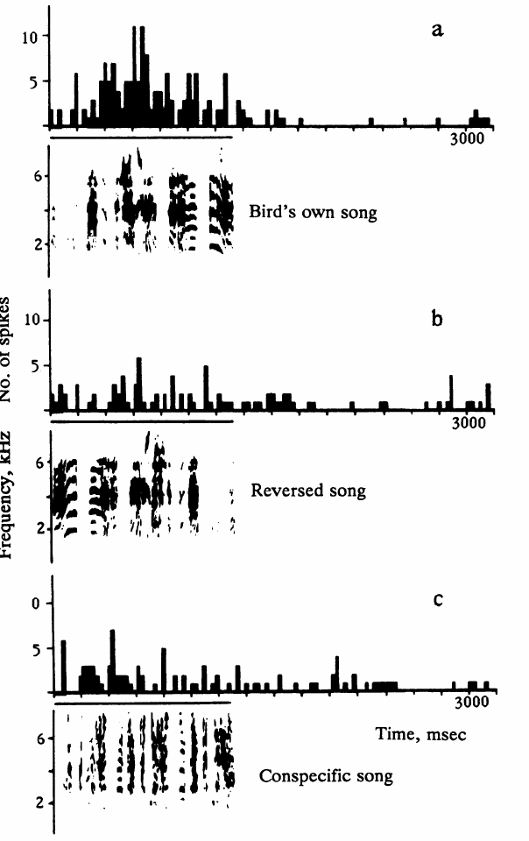
LMAN neurons prefer the individual’s own song
Doupe and Konishi recorded isolated auditory neurons in anesthetized adult male zebra finches. In LMAN, the bird's own song was more effective than songs produced by other zebra finches. The recordings used single units. The recordings compare the same neuron across each stimulus.
A peristimulus time histogram summarizes when spikes occur relative to repeated presentations of a stimulus. The histograms allow comparison of the temporal response to own song and to alternative acoustic patterns. Each stimulus is compared at the same single neuron.
Single-unit sampling narrows the measurement to one neuronal signal, unlike a multiunit cluster. The own-song preference characterizes an individual neuron's selectivity, and an active feedback comparison during the awake bird's singing is a separate measurement. Each neuron is tested with its own song, reversed song and another finch's song.
Doupe & Konishi (1991), Fig. 1. Published anatomical locations and pathways.
Doupe & Konishi (1991), Fig. 2. LMAN responses to own, reversed and conspecific song.
Doupe & Konishi (1991)
35
Notes:
Doupe and Konishi recorded isolated auditory neurons in anesthetized adult male zebra finches. In LMAN, the bird's own song was more effective than songs produced by other zebra finches.
A **peristimulus time histogram** summarizes when spikes occur relative to repeated presentations of a stimulus. The histograms allow comparison of the temporal response to own song and alternative acoustic patterns.
Single-unit sampling narrows the measurement to an isolated neuronal signal, unlike a multiunit cluster. The own-song preference still does not establish that the neuron compares actual feedback with a tutor memory while the awake bird is singing.
Own song, reversed own song, and another finch’s song were tested against the same isolated response. This separates within-neuron acoustic preference from comparisons between different sampled neurons.
References:
Doupe AJ, Konishi M (1991). Song-selective auditory circuits in the vocal control system of the zebra finch. Proceedings of the National Academy of Sciences USA 88(24): 11339–11343. https://doi.org/10.1073/pnas.88.24.11339

Slide 47
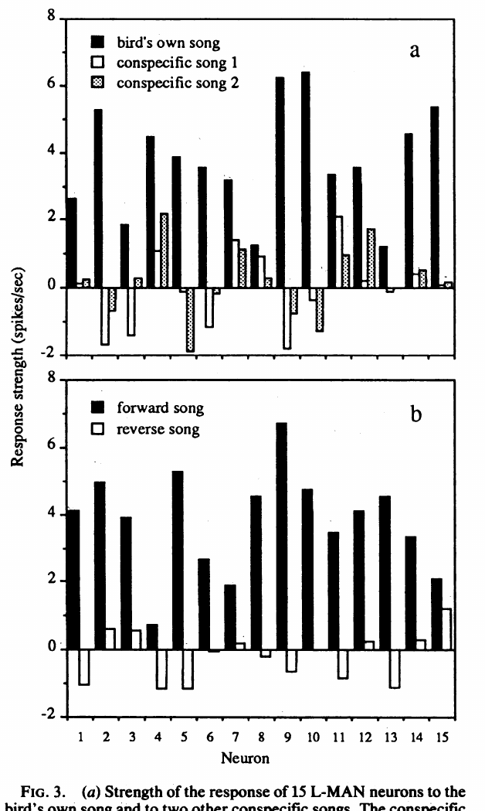
LMAN selectivity includes temporal song structure
Doupe and Konishi reversed the bird's own recorded song and compared its effect with forward playback. LMAN neurons responded much less effectively to the reversed version.
The manipulation retained overall spectral content while altering temporal structure. The response therefore depended on the acoustic signal's organization, rather than only on the presence of its constituent frequencies.
This control supports a complex auditory preference. It does not establish recognition of grammatical meaning, and it cannot separate sensitivity to syllable order from sensitivity to acoustic changes within reversed syllables; both are changed by whole-song reversal.
Whole-song reversal does not preserve the internal direction of acoustic sweeps. The control therefore tests temporal organization broadly rather than altering only the positions of intact syllables.
Doupe & Konishi (1991), Fig. 1. Published anatomical locations and pathways.
Doupe & Konishi (1991), Fig. 3. LMAN response strengths for song comparisons.
Doupe & Konishi (1991)
36
Notes:
Doupe and Konishi reversed the bird's own recorded song and compared its effect with forward playback. LMAN neurons responded much less effectively to the reversed version.
The manipulation retained overall spectral content while altering temporal structure. The response therefore depended on the acoustic signal's organization, rather than only on the presence of its constituent frequencies.
This control supports a complex auditory preference. It does not establish recognition of grammatical meaning, and it cannot separate sensitivity to syllable order from sensitivity to acoustic changes within reversed syllables; both are changed by whole-song reversal.
Whole-song reversal does not preserve the internal direction of acoustic sweeps. The control therefore tests temporal organization broadly rather than altering only the positions of intact syllables.
References:
Doupe AJ, Konishi M (1991). Song-selective auditory circuits in the vocal control system of the zebra finch. Proceedings of the National Academy of Sciences USA 88(24): 11339–11343. https://doi.org/10.1073/pnas.88.24.11339

Slide 48
Forward and reversed song engage LMAN differently
A reversed song plays the recording backward, which keeps the spectral content while changing the temporal order. Doupe and Konishi used reversal to test whether LMAN responds to song organization. Each comparison uses the same recording, so the only difference between conditions is the direction of playback.
LMAN neurons responded much less effectively to the reversed version than to forward song. The response therefore follows the sequence of sounds rather than the frequencies alone. The contrast was measured for each neuron against its own response to forward song.
This selectivity narrows the stimulus features that LMAN uses. Forward and reversed songs differ only in their arrangement, so the difference isolates temporal structure. The result is a direct test of whether the order of sounds matters to the neuron. Each neuron therefore serves as its own comparison.
Doupe & Konishi (1991), Fig. 1. Published anatomical locations and pathways.
Doupe & Konishi (1991), Fig. 3. LMAN response strengths for song comparisons.
Doupe & Konishi (1991)
36a
Notes:
Reversal separates temporal order from spectral content.
Reversal.
A reversed song keeps its spectral content.
The temporal order is changed.
Response.
LMAN responded much less to reversed song.
The sequence of sounds drives the response.
Selectivity.
Forward and reversed versions differ in arrangement only.
The difference isolates temporal structure.
Meaning.
LMAN is selective for temporal organization.
Frequency content alone is not sufficient.
Source values.
The published recordings and measurements come from the original paper.
Each result is reported with the condition used in the source.
Why the measure matters.
The result separates the measured property from the mechanism that produces it.
The comparison stays within the same birds, cells or recordings.
Interpretation.
Each result is read within the preparation and the age group that produced it.
The claim is restricted to the measured birds and conditions.
Context.
The parent figure shows the measurement that the paragraphs describe.
Each claim is tied to the recordings of the original study.
References:
Doupe AJ, Konishi M (1991). Song-selective auditory circuits in the vocal control system of the zebra finch. Proceedings of the National Academy of Sciences USA 88(24): 11339–11343. https://doi.org/10.1073/pnas.88.24.11339

Slide 49
Song responses extend through the accessory pathway
Doupe and Konishi also recorded auditory neurons in Area X and DLM, the nuclei upstream of LMAN in the accessory pathway. Own song was an effective stimulus in these areas as well. The accessory pathway carries song-selective responses at several points.
Responses to simpler noise and tone stimuli differed among nuclei. LMAN was less readily excited by broadband noise and more strictly selective for forward song than the upstream populations sampled. Selectivity sharpens along the pathway.
The comparison is consistent with different degrees of acoustic selectivity along the pathway. The recordings were made in adults and describe the adult circuit's selectivity, while learning in pupils is examined separately. The nuclei are compared within the same accessory pathway.
Doupe & Konishi (1991), Fig. 1. Published anatomical organization of song pathways.
Doupe & Konishi (1991)
37
Notes:
Doupe and Konishi also recorded auditory neurons in Area X and DLM, the nuclei upstream of LMAN in the accessory pathway. Own song was an effective stimulus in these areas as well.
Responses to simpler noise and tone stimuli differed among nuclei. LMAN was less readily excited by broadband noise and more strictly selective for forward song than the upstream populations sampled.
The comparison is consistent with different degrees of acoustic selectivity along the pathway. It does not prove that this adult circuit progressively constructs the juvenile tutor memory, because the recordings did not follow the development of individual pupils during learning.
References:
Doupe AJ, Konishi M (1991). Song-selective auditory circuits in the vocal control system of the zebra finch. Proceedings of the National Academy of Sciences USA 88(24): 11339–11343. https://doi.org/10.1073/pnas.88.24.11339

Slide 50
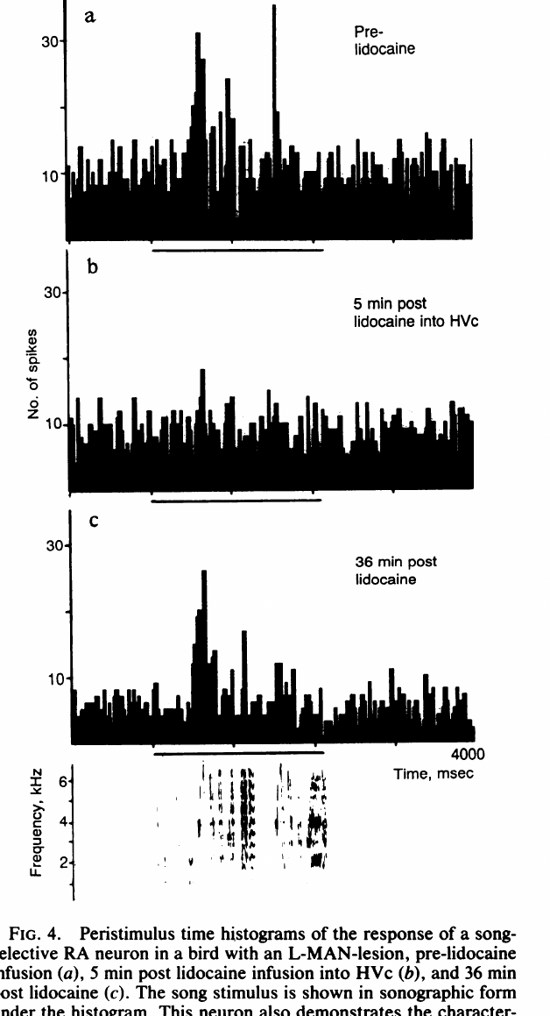
HVC silencing removes RA’s auditory song response
Doupe and Konishi recorded auditory responses in RA while altering its possible input sources. Song-selective RA responses remained after LMAN lesions or local anesthetic treatment of LMAN. The local anesthetic was applied directly to the target region.
Injecting lidocaine into HVC reversibly abolished RA song responses. Lidocaine silences the input region temporarily, which separates its contribution from the activity recorded in RA. Both the loss and the recovery follow the HVC injection. The same RA neurons are recorded throughout the treatment.
The loss and recovery implicate HVC-dependent input in adult RA auditory responsiveness. Persistence after LMAN disruption separates that input from the LMAN pathway. The additional HVC treatment tests a dependency that the LMAN manipulation alone would miss.
Doupe & Konishi (1991), Fig. 1. Published anatomical locations and pathways.
Doupe & Konishi (1991), Fig. 4. RA responses before, during and after HVC inactivation.
Doupe & Konishi (1991)
38
Notes:
Doupe and Konishi recorded auditory responses in RA while altering its possible input sources. Song-selective RA responses remained after LMAN lesions or local anesthetic treatment of LMAN.
Injecting lidocaine into HVC reversibly abolished RA song responses. **Lidocaine** is the local anesthetic used in this experiment to silence the input region temporarily, separating its contribution from the activity recorded in RA.
The loss and recovery implicate HVC-dependent input in adult RA auditory responsiveness. They do not establish that LMAN has no learning function, because adult playback responses and juvenile learning can depend differently on the same pathway.
Persistence after LMAN disruption distinguishes that input from an indispensable adult auditory drive. The additional HVC treatment tests a dependency that the LMAN manipulation alone could not establish.
References:
Doupe AJ, Konishi M (1991). Song-selective auditory circuits in the vocal control system of the zebra finch. Proceedings of the National Academy of Sciences USA 88(24): 11339–11343. https://doi.org/10.1073/pnas.88.24.11339

Slide 51
Reversible disruption separates input from lasting damage
In the RA recording example, Doupe and Konishi compared responses before HVC lidocaine, five minutes after treatment and after recovery. The reversible effect changed the same cell's response while the song stimulus remained available. The same cell is followed through each condition.
A reversible effect differs from destruction of RA itself. Recovery supports a temporary interruption of input rather than a permanent loss of the recorded neuron. The same neuron resumes its response when the input returns. The same cell is followed through each of the three conditions.
The experiment establishes a dependency under the adult anesthetized preparation. Regional inactivation affects multiple neurons and their local connections together, so the input is identified as a regional contribution. The before-and-after sequence keeps the song stimulus fixed while the input region's activity changes.
Doupe & Konishi (1991), Fig. 1. Published anatomical locations and pathways.
Doupe & Konishi (1991), Fig. 4. RA responses before, during and after HVC inactivation.
Doupe & Konishi (1991)
39
Notes:
In the RA recording example, Doupe and Konishi compared responses before HVC lidocaine, five minutes after treatment, and after recovery. The same cell's response changed while the song stimulus remained available.
A reversible effect is different from destruction of RA itself. Recovery supports a temporary interruption of input rather than an explanation requiring permanent loss of the recorded neuron.
The experiment establishes a dependency under the adult anesthetized preparation. It does not specify which HVC cell class supplied the input or reveal a complete feedback mechanism, because regional inactivation affects multiple neurons and local connections together.
The before-and-after sequence retains the song stimulus while changing the input region’s activity. Recovery adds evidence unavailable from a comparison involving only permanent destructive lesions.
References:
Doupe AJ, Konishi M (1991). Song-selective auditory circuits in the vocal control system of the zebra finch. Proceedings of the National Academy of Sciences USA 88(24): 11339–11343. https://doi.org/10.1073/pnas.88.24.11339

Slide 52
Reversible inactivation reveals a dependency in RA
Reversible inactivation temporarily silences a region and then allows its activity to return. Doupe and Konishi used lidocaine in HVC to test whether RA auditory responses depend on HVC input. The same song stimulus was presented throughout, so the input region is the only variable changed.
RA responses returned after the drug wore off. Recovery shows that the loss came from a temporary block of HVC rather than from damage to RA. The timing of the return matches the timing of the drug's effect, which strengthens the link between the two. The recovery is measured against the same cell's baseline.
A recorded neuron can be measured before, during and after the same intervention. This design separates a dependency from permanent injury to the recorded neuron. Each stage of the sequence is compared with the same cell's earlier response, so the recovery is judged against that cell's own baseline.
Doupe & Konishi (1991), Fig. 1. Published anatomical locations and pathways.
Doupe & Konishi (1991), Fig. 4. RA responses before, during and after HVC inactivation.
Doupe & Konishi (1991)
39a
Notes:
Reversible inactivation shows a dependency on input.
Inactivation.
Lidocaine was injected into HVC.
The block silenced the input region temporarily.
Recovery.
RA responses returned after the drug wore off.
The loss was reversible.
Design.
One neuron was measured before, during and after treatment.
The stimulus was held constant.
Meaning.
RA auditory responses depend on HVC input.
The dependency is separated from damage.
Source values.
The published recordings and measurements come from the original paper.
Each result is reported with the condition used in the source.
Why the measure matters.
The result separates the measured property from the mechanism that produces it.
The comparison stays within the same birds, cells or recordings.
Interpretation.
Each result is read within the preparation and the age group that produced it.
The claim is restricted to the measured birds and conditions.
Context.
The parent figure shows the measurement that the paragraphs describe.
Each claim is tied to the recordings of the original study.
References:
Doupe AJ, Konishi M (1991). Song-selective auditory circuits in the vocal control system of the zebra finch. Proceedings of the National Academy of Sciences USA 88(24): 11339–11343. https://doi.org/10.1073/pnas.88.24.11339

Slide 53
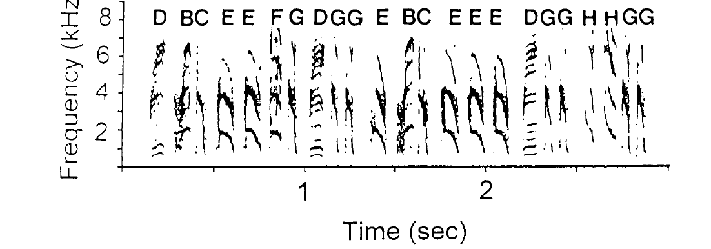
Adult Bengalese song retains variable note sequences
Bengalese finches, Lonchura striata var. domestica, produce learned songs with recurring motifs but variable note sequences. Okanoya and Yamaguchi distinguished individual notes from motifs, which are recurring groups of notes. The distinction gives each song two levels of organization.
A spectrogram records frequency over time and allows corresponding note types to be followed across renditions. Adult variability in sequence coexists with recognizable note identities. The notes keep their form while their order changes. Each note type is tracked through the same spectrogram display.
A stable inventory is different from an invariant sequence. This distinction matters when testing auditory feedback, because a bird can preserve many acoustic units while changing the order or frequency with which it assembles them into song. Each level can be measured separately.
Okanoya & Yamaguchi (1997), Fig. 1. Adult Bengalese finch notes and motifs.
Okanoya & Yamaguchi (1997)
40
Notes:
**Bengalese finches**, _Lonchura striata_ var. _domestica_, produce learned songs with recurring motifs but variable note sequences. Okanoya and Yamaguchi distinguished individual notes from motifs, which are recurring groups of notes.
A **spectrogram** records frequency over time and permits corresponding note types to be followed across renditions. Adult variability in sequence can coexist with recognizable note identities.
A stable inventory is therefore different from an invariant sequence. This distinction matters when testing auditory feedback: a bird can preserve many acoustic units while changing the order or frequency with which it assembles them into song.
Notes were identified from acoustic form before their transition patterns were analyzed. The distinction between note identity and arrangement allows separate descriptions of the same adult vocal performance.
References:
Okanoya K, Yamaguchi A (1997). Adult Bengalese finches (Lonchura striata var. domestica) require real-time auditory feedback to produce normal song syntax. Journal of Neurobiology 33(4): 343–356. https://doi.org/10.1002/(SICI)1097-4695(199710)33:4<343::AID-NEU1>3.0.CO;2-A

Slide 54
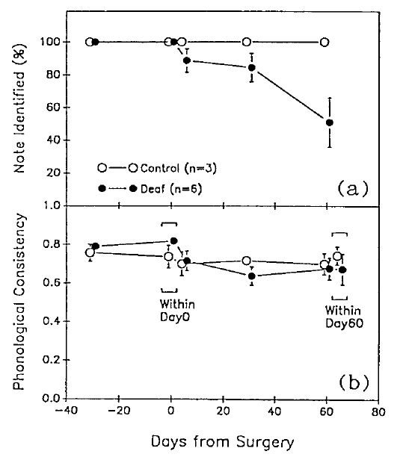
Adult deafening tests maintenance after learning
Okanoya and Yamaguchi removed auditory feedback after Bengalese finches had developed adult song. They compared subsequent recordings with each bird's preoperative song and with hearing controls. The preoperative song serves as each bird's own reference.
Changes appeared within five days, although the birds were not acquiring an entirely new juvenile repertoire. The experiment therefore tested the maintenance and organization of a learned performance. Adult song changes after the feedback loss.
A closed-ended learner normally acquires its repertoire during a limited developmental interval. That label applies to acquisition, while adult production can still depend on hearing, since limiting new learning and maintaining existing material are separate functions.
Okanoya & Yamaguchi (1997), Fig. 3. Note types and similarity after surgery.
Okanoya & Yamaguchi (1997)
41
Notes:
Okanoya and Yamaguchi removed auditory feedback after Bengalese finches had developed adult song. They compared subsequent recordings with each bird's preoperative song and with hearing controls.
Changes could arise within five days, even though the birds were not acquiring an entirely new juvenile repertoire. The experiment therefore tested maintenance and organization of a learned performance.
A **closed-ended learner** normally acquires its repertoire during a limited developmental interval. That label does not imply that adult production is independent of hearing: restricting acquisition of new material and maintaining existing material are separate functional properties.
Adult recordings established the preoperative song pattern. Subsequent changes therefore occurred after an existing repertoire had been acquired, rather than merely reflecting failure to hear a juvenile tutor.
References:
Okanoya K, Yamaguchi A (1997). Adult Bengalese finches (Lonchura striata var. domestica) require real-time auditory feedback to produce normal song syntax. Journal of Neurobiology 33(4): 343–356. https://doi.org/10.1002/(SICI)1097-4695(199710)33:4<343::AID-NEU1>3.0.CO;2-A

Slide 55
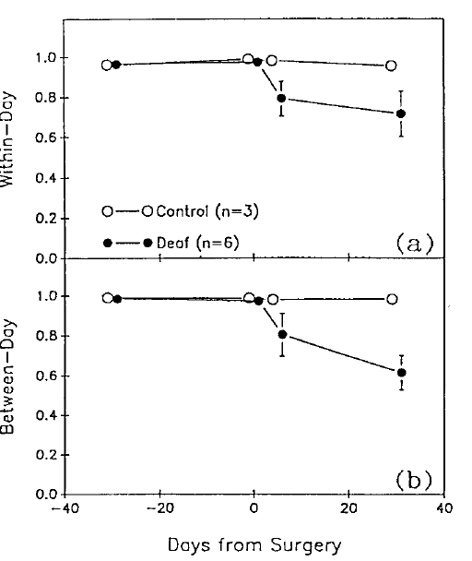
Sequence organization deteriorates after feedback loss
Okanoya and Yamaguchi followed transitions between recognizable song notes before and after deafening. They assessed whether a note was followed by the same alternatives with similar consistency across recordings. The transition pattern measures the sequence.
Sequence organization became abnormal in deafened birds, while hearing controls retained more stable patterns. Song syntax here means the ordering of vocal units, rather than the semantic grammar of human language. The term follows the vocal units, not meaning.
The comparison establishes a role for auditory feedback in maintaining adult sequence organization. Each deafened bird is compared with its own preoperative pattern, so the relevant measure is whether its existing organization remained stable over time.
Okanoya & Yamaguchi (1997), Fig. 4. Sequence variation and consistency after surgery.
Okanoya & Yamaguchi (1997)
42
Notes:
Okanoya and Yamaguchi followed transitions between recognizable song notes before and after deafening. They assessed whether a note was followed by the same alternatives with similar consistency across recordings.
Sequence organization became abnormal in deafened birds, while hearing controls retained more stable patterns. **Song syntax** here means the ordering of vocal units, rather than the semantic grammar of human language.
The comparison establishes a role for auditory feedback in maintaining adult sequence organization. It does not identify a particular comparator neuron or prove that every transition requires an instantaneous conscious response to hearing the preceding note.
The preoperative pattern supplies a personal reference for sequence change. The relevant comparison is not whether every rendition was identical, but whether its existing organization remained stable over time.
References:
Okanoya K, Yamaguchi A (1997). Adult Bengalese finches (Lonchura striata var. domestica) require real-time auditory feedback to produce normal song syntax. Journal of Neurobiology 33(4): 343–356. https://doi.org/10.1002/(SICI)1097-4695(199710)33:4<343::AID-NEU1>3.0.CO;2-A

Slide 56
Okanoya and Yamaguchi tracked sequence changes
Syntax in this study means the ordering of vocal units within a song. Okanoya and Yamaguchi tracked the order of recognizable notes before and after deafening, so the sequence can be described as a set of transitions. The note labels were kept constant across recordings.
Deafened birds showed abnormal sequence organization compared with hearing controls. Their preoperative songs served as each bird's own reference, which makes the change measurable within the individual. Hearing controls kept stable patterns across the same interval.
Each transition is judged by how consistently it recurs across recordings. Sequence stability therefore becomes a property that the loss of feedback can alter. The same transitions are counted before and after surgery, so each change is a direct comparison.
Okanoya & Yamaguchi (1997), Fig. 4. Sequence variation and consistency after surgery.
Okanoya & Yamaguchi (1997)
42a
Notes:
Syntax describes the ordering of vocal units.
Syntax.
Syntax here means the order of vocal units.
It is not the grammar of human language.
Transitions.
Notes were followed across recordings.
Each transition was judged for consistency.
Controls.
Hearing controls kept more stable patterns.
Deafened birds were compared with their own songs.
Meaning.
Feedback loss alters sequence stability.
The preoperative song is the reference.
Source values.
The published recordings and measurements come from the original paper.
Each result is reported with the condition used in the source.
Why the measure matters.
The result separates the measured property from the mechanism that produces it.
The comparison stays within the same birds, cells or recordings.
Interpretation.
Each result is read within the preparation and the age group that produced it.
The claim is restricted to the measured birds and conditions.
Context.
The parent figure shows the measurement that the paragraphs describe.
Each claim is tied to the recordings of the original study.
References:
Okanoya K, Yamaguchi A (1997). Adult Bengalese finches (Lonchura striata var. domestica) require real-time auditory feedback to produce normal song syntax. Journal of Neurobiology 33(4): 343–356. https://doi.org/10.1002/(SICI)1097-4695(199710)33:4<343::AID-NEU1>3.0.CO;2-A

Slide 57
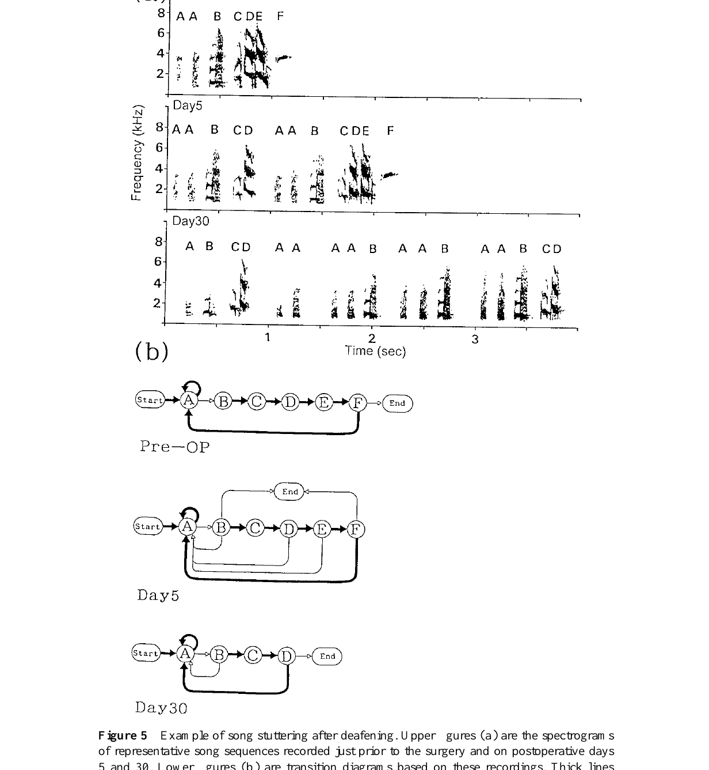
Stuttering can preserve notes while changing repetition
Some deafened Bengalese finches repeated particular notes excessively. Okanoya and Yamaguchi illustrated this stuttering with spectrograms and the corresponding changes in note-transition patterns. The repeated notes remained recognizable.
The acoustic identity of a repeated note stayed recognizable even when its repetition became abnormal. Loss of hearing affected the organization of an existing unit rather than replacing every sound with a novel one. Sequencing changed while sound identity remained.
This case separates the integrity of individual notes from control of their sequencing. Post-deafening changes therefore take different forms, and different aspects of song deteriorate in different ways. The repeated note sits in a changed sequence context, which makes its excess repetition measurable.
Okanoya & Yamaguchi (1997), Fig. 5. Post-deafening stuttering.
Okanoya & Yamaguchi (1997)
43
Notes:
Some deafened Bengalese finches repeated particular notes excessively. Okanoya and Yamaguchi illustrated this **stuttering** with spectrograms and the corresponding changes in note-transition patterns.
The acoustic identity of a repeated note could remain recognizable even when its repetition became abnormal. Loss of hearing therefore affected the organization of an existing unit, rather than necessarily replacing every sound with a novel one.
This case separates the integrity of individual notes from control of their sequencing. It also prevents treating all post-deafening changes as one uniform loss of acoustic quality; different aspects of song can deteriorate in different ways.
The repeated note occupies a changed sequence context. Recognizing its acoustic identity makes the excess repetition measurable even when the bird retains the capacity to produce that sound.
References:
Okanoya K, Yamaguchi A (1997). Adult Bengalese finches (Lonchura striata var. domestica) require real-time auditory feedback to produce normal song syntax. Journal of Neurobiology 33(4): 343–356. https://doi.org/10.1002/(SICI)1097-4695(199710)33:4<343::AID-NEU1>3.0.CO;2-A

Slide 58
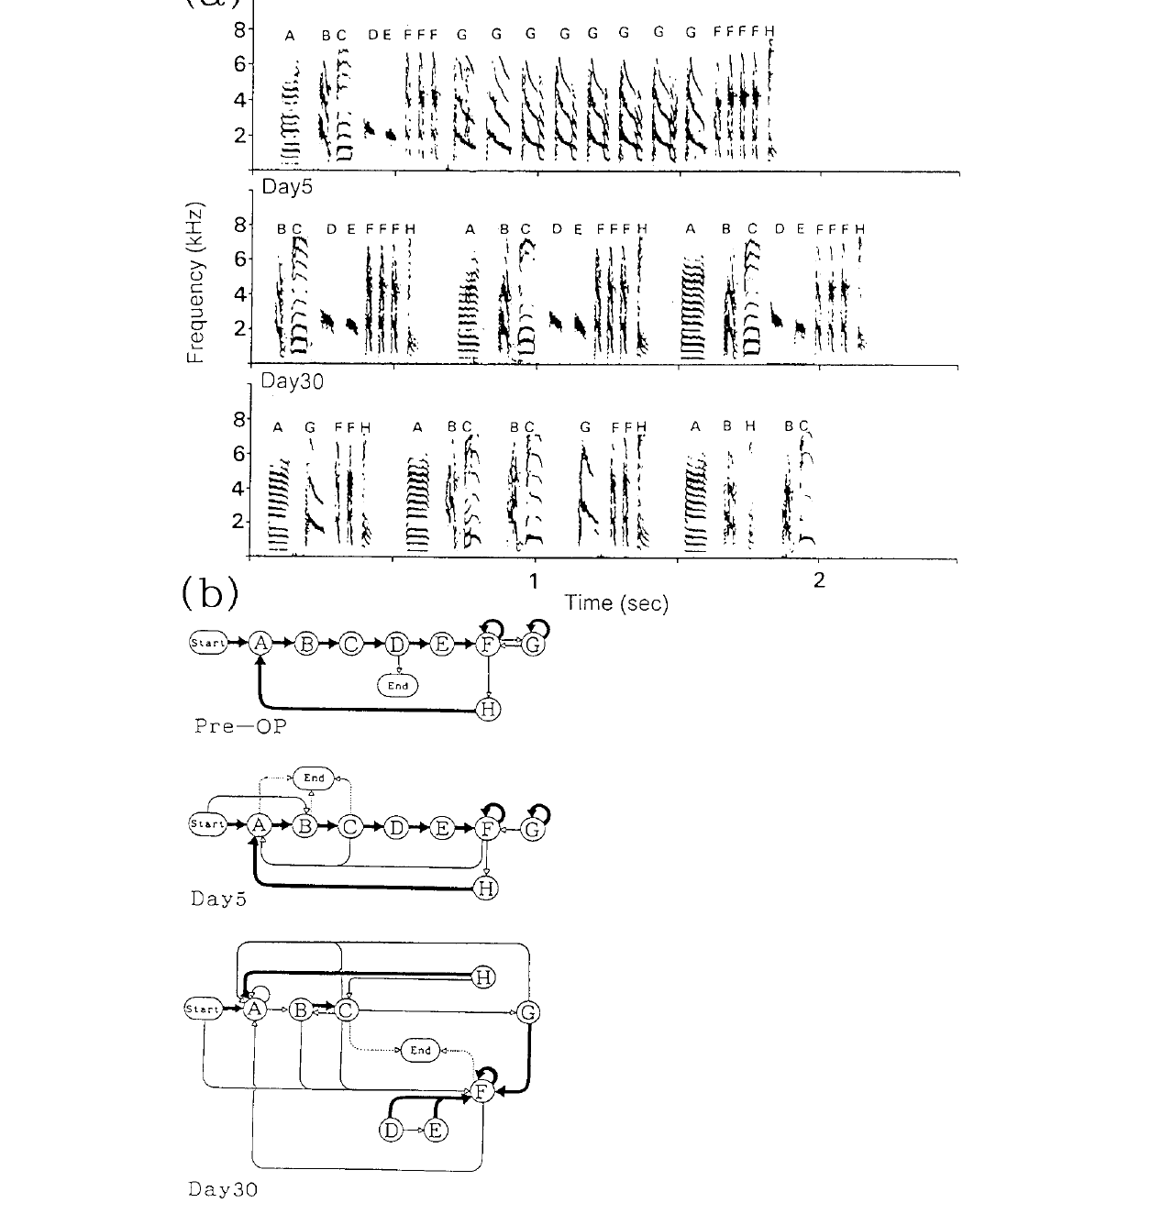
Scrambling changes relations among retained song units
Other deafened Bengalese finches developed scrambled song, with altered transitions among recognizable notes. Okanoya and Yamaguchi tracked these changes relative to the same individual's preoperative sequence. The individual's own record is the baseline.
The resulting organization differed from simple repetition of one note. Some expected units were omitted, while new relationships among surviving units appeared as the song deteriorated. The changes affected the links between notes. Each labeled cell is matched to the recording that produced it.
These longitudinal examples show individual variation in how feedback loss unfolds. Birds deteriorated to different degrees, and each bird's own preoperative song serves as its baseline. The spectrograms keep the original note labels across recordings, so omitted notes and altered transitions are distinguished from wholesale replacement.
Okanoya & Yamaguchi (1997), Fig. 6. Post-deafening scrambling.
Okanoya & Yamaguchi (1997)
44
Notes:
Other deafened Bengalese finches developed **scrambled** song, with altered transitions among recognizable notes. Okanoya and Yamaguchi tracked these changes relative to the same individual's preoperative sequence.
The resulting organization differed from simple repetition of one note. Some expected units could be omitted, while new relationships among surviving units appeared as the song deteriorated.
These longitudinal examples support individual variation in the consequences of feedback loss. A group tendency does not require identical deterioration in every bird, and a single characteristic example cannot establish that all species or all adults respond to deafening in the same way.
The study’s spectrograms retain the original note labels across recordings. Those labels allow omissions and altered transitions to be distinguished from wholesale replacement of the acoustic repertoire.
References:
Okanoya K, Yamaguchi A (1997). Adult Bengalese finches (Lonchura striata var. domestica) require real-time auditory feedback to produce normal song syntax. Journal of Neurobiology 33(4): 343–356. https://doi.org/10.1002/(SICI)1097-4695(199710)33:4<343::AID-NEU1>3.0.CO;2-A

Slide 59
A learned repertoire can remain dependent on hearing
The Bengalese finch experiments separate acquisition of song from maintenance of adult performance. Removing auditory feedback after learning disrupted sequence organization despite the persistence of recognizable vocal material.
Marler's early tutoring and memory experiments establish retained acoustic information; the adult deafening experiment establishes that stabilized production can still require sensory support. These are complementary requirements rather than interchangeable measurements.
The template model remains a functional account of stored targets and feedback-guided adjustment. The supplied studies establish several necessary relationships, while leaving the precise storage site and the mechanism converting mismatch into corrective neural change unresolved.
A sensory requirement for maintenance can persist beyond the interval for acquiring new song models. Stable adult performance therefore does not prove that the underlying motor control has become impervious to experience.
Okanoya & Yamaguchi (1997), Fig. 4. Sequence variation and consistency after surgery.
Okanoya & Yamaguchi (1997); Brainard & Doupe (2000)
45
Notes:
The Bengalese finch experiments separate acquisition of song from maintenance of adult performance. Removing auditory feedback after learning disrupted sequence organization despite the persistence of recognizable vocal material.
Marler's early tutoring and memory experiments establish retained acoustic information; the adult deafening experiment establishes that stabilized production can still require sensory support. These are complementary requirements rather than interchangeable measurements.
The template model remains a functional account of stored targets and feedback-guided adjustment. The supplied studies establish several necessary relationships, while leaving the precise storage site and the mechanism converting mismatch into corrective neural change unresolved.
A sensory requirement for maintenance can persist beyond the interval for acquiring new song models. Stable adult performance therefore does not prove that the underlying motor control has become impervious to experience.
References:
Okanoya K, Yamaguchi A (1997). Adult Bengalese finches (Lonchura striata var. domestica) require real-time auditory feedback to produce normal song syntax. Journal of Neurobiology 33(4): 343–356. https://doi.org/10.1002/(SICI)1097-4695(199710)33:4<343::AID-NEU1>3.0.CO;2-A
Brainard MS, Doupe AJ (2000). Auditory feedback in learning and maintenance of vocal behaviour. Nature Reviews Neuroscience 1: 31–40. https://doi.org/10.1038/35036205

Slide 60
Key takeaways
Sensitive periods depend on the outcome measured. Early playback supports detailed copying; later exposure can influence broad organization without reproducing tutor syllables.
Predispositions constrain learning. White-crowned sparrows learn conspecific models selectively under the tested playback conditions; experience supplies detailed dialect structure.
A retained target can precede mature singing. Swamp sparrows reproduce syllables heard months earlier, and adult repertoires omit material expressed during plastic song.
Own-song selectivity is not proof of tutor-memory storage. Konishi coauthored recordings establish auditory preferences and motor associations, while leaving the template’s exact neural substrate unresolved.
Behavioral state changes auditory responses. HVC playback responses differ from singing-related discharge and can be suppressed around vocal production.
Adult song stability can depend on feedback. Bengalese finch deafening disrupts sequence organization after acquisition; restricting repertoire learning does not imply independence from hearing.
Notes:
Sensitive periods depend on the outcome measured. Early playback supports detailed copying; later exposure can influence broad organization without reproducing tutor syllables.
Predispositions constrain learning. White-crowned sparrows learn conspecific models selectively under the tested playback conditions; experience supplies detailed dialect structure.
A retained target can precede mature singing. Swamp sparrows reproduce syllables heard months earlier, and adult repertoires omit material expressed during plastic song.
Own-song selectivity is not proof of tutor-memory storage. Konishi coauthored recordings establish auditory preferences and motor associations, while leaving the template’s exact neural substrate unresolved.
Behavioral state changes auditory responses. HVC playback responses differ from singing-related discharge and can be suppressed around vocal production.
Adult song stability can depend on feedback. Bengalese finch deafening disrupts sequence organization after acquisition; restricting repertoire learning does not imply independence from hearing.
References:
Marler P (1970). A comparative approach to vocal learning: Song development in white-crowned sparrows. Journal of Comparative and Physiological Psychology 71(2, Pt. 2): 1–25. https://doi.org/10.1037/h0029144
Marler P, Peters S (1981). Sparrows learn adult song and more from memory. Science 213(4509): 780–782. https://doi.org/10.1126/science.213.4509.780
Margoliash D, Konishi M (1985). Auditory representation of autogenous song in the song system of white-crowned sparrows. Proceedings of the National Academy of Sciences USA 82(17): 5997–6000. https://doi.org/10.1073/pnas.82.17.5997
McCasland JS, Konishi M (1981). Interaction between auditory and motor activities in an avian song control nucleus. Proceedings of the National Academy of Sciences USA 78(12): 7815–7819. https://doi.org/10.1073/pnas.78.12.7815
Doupe AJ, Konishi M (1991). Song-selective auditory circuits in the vocal control system of the zebra finch. Proceedings of the National Academy of Sciences USA 88(24): 11339–11343. https://doi.org/10.1073/pnas.88.24.11339
Okanoya K, Yamaguchi A (1997). Adult Bengalese finches (Lonchura striata var. domestica) require real-time auditory feedback to produce normal song syntax. Journal of Neurobiology 33(4): 343–356. https://doi.org/10.1002/(SICI)1097-4695(199710)33:4<343::AID-NEU1>3.0.CO;2-A
Brainard MS, Doupe AJ (2000). Auditory feedback in learning and maintenance of vocal behaviour. Nature Reviews Neuroscience 1: 31–40. https://doi.org/10.1038/35036205

