Slide 1
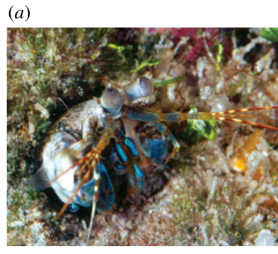
NEUR 411 · NEUROETHOLOGY · FALL 2026
Lecture 13
Mantis shrimp vision:
hyperspectral and polarization sensing
Wednesday, September 23, 2026
Jordan Lopez, Ph.D.
Professor of Neurobiology & Biomedical Engineering
Bok et al. (2018), Fig. 1(a). Haptosquilla trispinosa in its natural burrow; original photograph by Roy Caldwell.
Notes:
Mantis shrimp vision: hyperspectral and polarization sensing
Lecture 13. NEUR 411 · NEUROETHOLOGY · FALL 2026. Wednesday, September 23, 2026.
Figure: Bok et al. (2018), Fig. 1(a). Haptosquilla trispinosa in its natural burrow; original photograph by Roy Caldwell.
Figure source: https://doi.org/10.1098/rspb.2018.1384
References:
Bok MJ, Roberts NW, Cronin TW (2018). Behavioural evidence for polychromatic ultraviolet sensitivity in mantis shrimp. Proceedings of the Royal Society B: Biological Sciences 285: 20181384. https://doi.org/10.1098/rspb.2018.1384
Original article photograph credit: Roy Caldwell, credited by Bok et al. (2018) for Fig. 1(a). The photograph retains its published pixels.

Slide 2
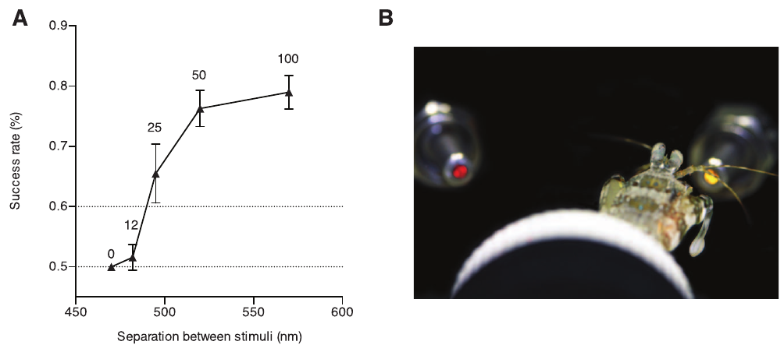
Learned choices measure wavelength discrimination
Mantis shrimps are stomatopods, marine crustacean predators with compound eyes. Spectral discrimination is the ability to distinguish lights of different wavelengths, measured in nanometers (nm). A retina with many narrow spectral channels is sometimes described as hyperspectral; the channel count alone does not specify the animal's discrimination threshold.
Thoen and colleagues trained Haptosquilla trispinosa to associate a particular wavelength with food. Two optical fibers presented narrow-band lights, and grabbing or tapping a fiber registered a choice. Test wavelengths varied relative to the rewarded wavelength.
Widely separated wavelengths supported successful choices. The assay measures a learned visual decision in a controlled feeding context, rather than the number of colors experienced subjectively or performance in every natural hunting task.
Thoen et al. (2014), Fig. 2(A, B). Food-associated wavelength choices in Haptosquilla trispinosa.
Thoen et al. (2014)
02
Notes:
• A wavelength describes a physical property of the stimulus. Discrimination requires a behavioral difference between two stimuli, so counting receptor classes cannot establish the smallest difference an animal can detect.
• The optical fibers supplied the comparison lights while the animal chose a fiber end. Food association gave the wavelength a behavioral consequence; the test then varied the distance between wavelengths.
• Successful choices establish that spectral information can guide this learned response. They do not define a human-like color experience or establish the mechanism that converts receptor signals into the choice.
References:
Thoen HH, How MJ, Chiou TH, Marshall J (2014). A Different Form of Color Vision in Mantis Shrimp. Science 343: 411-413. https://doi.org/10.1126/science.1245824
Figure: Thoen et al. (2014), Fig. 2(A, B). Food-associated wavelength choices in Haptosquilla trispinosa.
Figure source: https://doi.org/10.1126/science.1245824

Slide 3
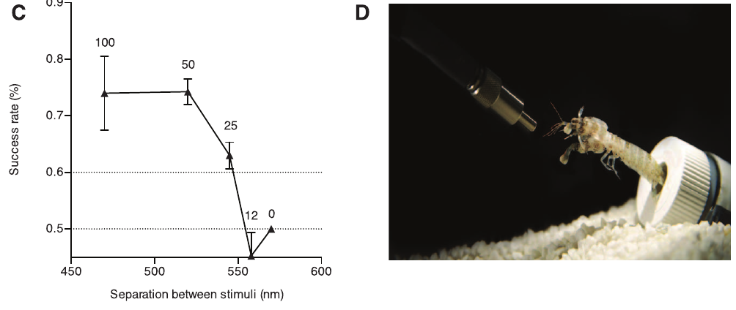
Rewarded wavelengths can be tested from both sides
A narrow-band stimulus concentrates its light within a limited wavelength range. Thoen and colleagues trained separate animals to lights between 400 and 650 nm, including 470 and 570 nm, then paired the trained light with an alternative delivered through another optical fiber.
Tests approached the trained wavelength from longer or shorter wavelengths. At separations of approximately 50–100 nm, correct choices were commonly 70–80%. As the alternatives approached the rewarded wavelength, performance declined toward the 50% chance level of a two-choice task.
Testing multiple trained wavelengths prevents one exceptionally easy color pair from defining the whole visual system. The response remains a food-associated choice; it does not reveal which receptor channel, interneuron or synapse supplied the decision signal.
Thoen et al. (2014), Fig. 2(C, D). Choices toward shorter test wavelengths after 570-nm training.
Thoen et al. (2014)
03
Notes:
• The trained wavelength is the stimulus associated with reward, while the test wavelength is the competing stimulus. The two are roles in the assay rather than permanent biological categories.
• Training at 470 nm permitted comparisons toward longer wavelengths, and training at 570 nm permitted comparisons toward shorter wavelengths. Both directions produced poorer choices when the alternatives approached one another.
• Chance is one correct choice in two because there are two available fibers. The decline toward chance indicates loss of discrimination under these conditions, not a failure to detect light at all.
References:
Thoen HH, How MJ, Chiou TH, Marshall J (2014). A Different Form of Color Vision in Mantis Shrimp. Science 343: 411-413. https://doi.org/10.1126/science.1245824
Figure: Thoen et al. (2014), Fig. 2(C, D). Choices toward shorter test wavelengths after 570-nm training.
Figure source: https://doi.org/10.1126/science.1245824

Slide 4
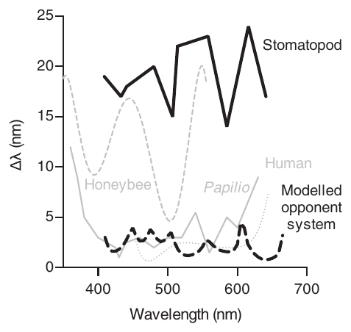
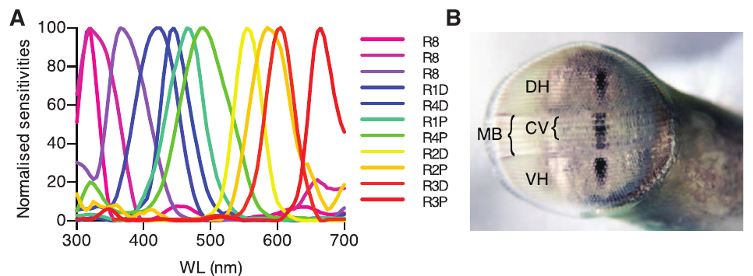
Fine receptor tuning exceeds behavioral resolution
The discrimination threshold is the stimulus separation associated with a specified performance criterion. Thoen and colleagues used 60% correct choices to estimate the minimum discriminable wavelength difference in Haptosquilla trispinosa.
Behavioral thresholds fell approximately between 12 and 25 nm across the tested visible spectrum. Their receptor-noise model, which assumed comparisons between adjacent spectral channels, predicted substantially finer differences of approximately 1–5 nm. Intracellular recordings supplied the receptor sensitivities used in that prediction.
The mismatch challenges that specific efficient opponent-model account. It does not establish that every spectral comparison is absent: later behavioral evidence supports some opponent processing. Receptor tuning, model assumptions and measured discrimination are separate levels of evidence.
Thoen et al. (2014), Fig. 3. Measured wavelength thresholds and the authors’ opponent-model prediction.
Thoen et al. (2014), Fig. 1(A, B). Recorded receptor sensitivities normalized to their peaks.
Thoen et al. (2014)
04
Notes:
• The study chose a fixed correct-choice criterion and interpolated the tested wavelength pairs to estimate thresholds. Those thresholds describe the animal's performance in this assay.
• A prediction derived from recorded sensitivities also depends on assumptions about noise and channel comparison. Narrow receptor tuning makes fine discrimination possible under the model but does not guarantee that the animal performs the assumed computation.
• The discrepancy supports caution about deriving perception directly from receptor diversity. The later grey-target experiments test a different consequence of spectral comparison and prevent treating coarse thresholds as proof that all opponency is absent.
References:
Thoen HH, How MJ, Chiou TH, Marshall J (2014). A Different Form of Color Vision in Mantis Shrimp. Science 343: 411-413. https://doi.org/10.1126/science.1245824
Figure: Thoen et al. (2014), Fig. 3. Measured wavelength thresholds and the authors’ opponent-model prediction.
Figure source: https://doi.org/10.1126/science.1245824
Figure: Thoen et al. (2014), Fig. 1(A, B). Recorded receptor sensitivities normalized to their peaks.
Figure source: https://doi.org/10.1126/science.1245824

Slide 5
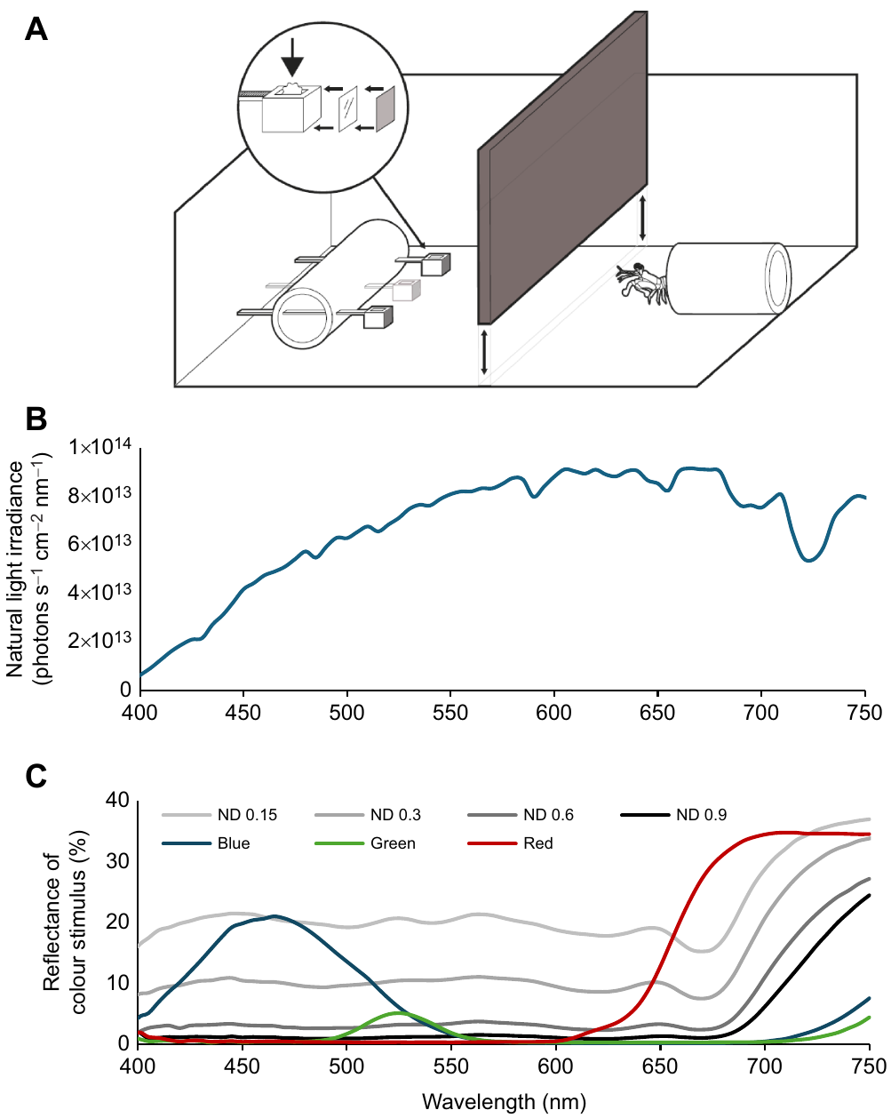
Grey distractors control brightness and target position
Color vision distinguishes spectral composition despite variation in overall intensity. Wang and Marshall tested Haptosquilla trispinosa with one colored cable-tie target and two grey distractors, using four neutral-density filter levels to vary distractor brightness.
Targets were about 4 × 4 mm and initially 5–8 cm from the animal. Positions and grey combinations varied across trials. Testing used new, uncontaminated cable ties; food was delivered only after a correct choice, reducing odor cues associated with the rewarded target.
Animals could approach and inspect the stimuli before grasping or tapping one. This design separates a spectral choice from a fixed side or simple brightness preference. It does not isolate the eyes from all movements or record the neurons that compare spectral inputs.
Wang & Marshall (2025), Fig. 3(A–C). Three-choice chamber, illumination and stimulus reflectance spectra.
Wang & Marshall (2025)
05
Notes:
• Neutral-density distractors provide several brightness alternatives rather than one fixed grey comparison. Changing their positions also prevents one location from consistently predicting food.
• The test targets contained no food during the decision. A reward arrived after the correct response, so the food association remained while a target-specific odor cue was reduced.
• The animals were free to change viewing distance and angle. The choice is therefore a behavioral test of available visual information, while active inspection and the intervening neural computations remain part of the intact response.
References:
Wang CWJ, Marshall NJ (2025). Behavioural evidence of spectral opponent processing in the visual system of stomatopod crustaceans. Journal of Experimental Biology 228: jeb247952. https://doi.org/10.1242/jeb.247952
Figure: Wang & Marshall (2025), Fig. 3(A–C). Three-choice chamber, illumination and stimulus reflectance spectra.
Figure source: https://doi.org/10.1242/jeb.247952

Slide 6
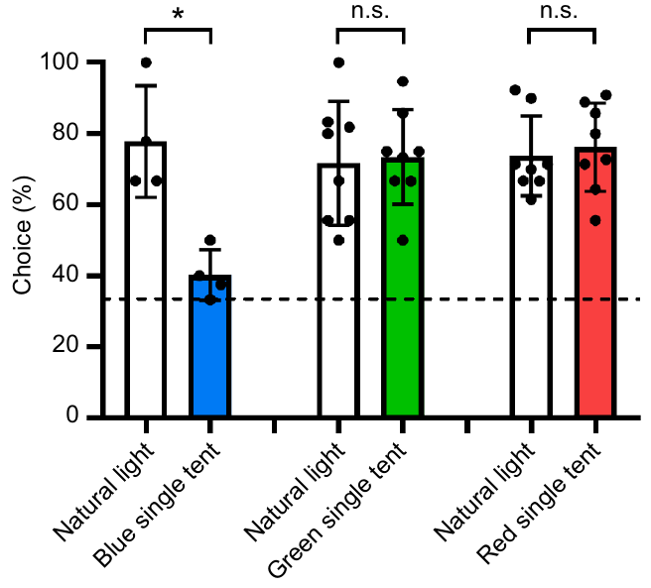
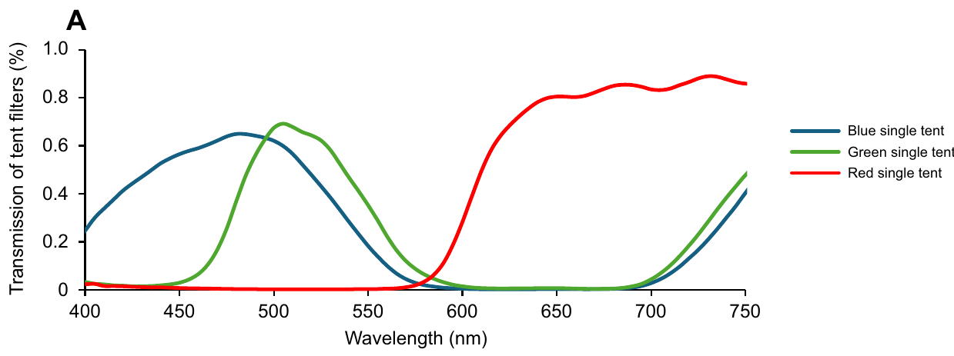
Restricted illumination preserves some color choices
Spectral opponency compares signals from receptors with different wavelength sensitivities. Wang and Marshall restricted illumination with blue, green or red filter tents while trained Haptosquilla trispinosa chose colored targets against grey alternatives. Each group encountered its corresponding illumination color.
Under green and red illumination, correct choices remained about three-quarters of responses, above the one-third chance level of three alternatives. Blue-target performance fell from 76% under natural light to 40% under blue illumination. The spectral windows therefore produced different behavioral outcomes.
The authors interpret preserved green and red discrimination as evidence for opponent processing when only a restricted receptor subset receives substantial light. This supports spectral comparison, but neither identifies its neurons nor establishes the proposed hybrid system's complete mechanism.
Wang & Marshall (2025), Fig. 7. Color-versus-grey choices under natural and colored illumination.
Wang & Marshall (2025), Fig. 5(A). Measured transmission of the illumination filters.
Wang & Marshall (2025)
06
Notes:
• Restricting the illumination changes the spectrum reaching both target and distractors. The experiment tests whether the remaining receptor signals still contain a usable distinction between color and grey.
• Green and red choices survived their corresponding restricted illuminations, whereas blue choices approached chance. The outcome depends on the target spectrum and the illumination together.
• The behavioral result qualifies the earlier claim that coarse wavelength discrimination rules out opponency. The proposed combination of channel recognition and opponent comparison remains an interpretation rather than a fully recorded circuit.
References:
Wang CWJ, Marshall NJ (2025). Behavioural evidence of spectral opponent processing in the visual system of stomatopod crustaceans. Journal of Experimental Biology 228: jeb247952. https://doi.org/10.1242/jeb.247952
Figure: Wang & Marshall (2025), Fig. 7. Color-versus-grey choices under natural and colored illumination.
Figure source: https://doi.org/10.1242/jeb.247952
Figure: Wang & Marshall (2025), Fig. 5(A). Measured transmission of the illumination filters.
Figure source: https://doi.org/10.1242/jeb.247952

Slide 7
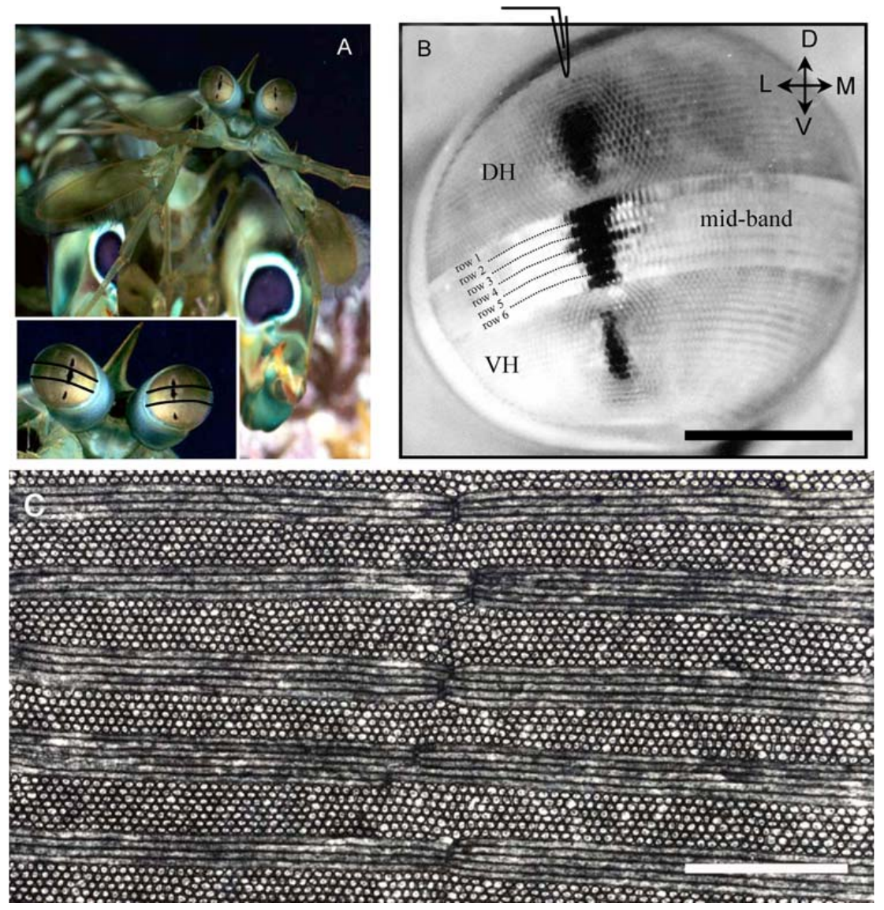
Three eye regions sample overlapping visual space
A compound eye contains repeated optical units called ommatidia. In six-rowed stomatopod eyes, a specialized midband separates the dorsal and ventral hemispheres. Each ommatidium contains photoreceptor cells whose light-sensitive membrane contributes to a central rhabdom.
Kleinlogel and White examined Gonodactylus smithii eyes and recorded from identified photoreceptors. The three dark pseudopupils arise where ommatidia facing the observer absorb light strongly. Their simultaneous appearance reflects overlap between the visual fields of the two hemispheres and the midband.
Overlap permits different receptor populations to sample related directions while supplying distinct spectral or polarization signals. The optical arrangement is anatomical evidence; it does not establish that every downstream neuron combines all three regions or that all stomatopod species share identical specialization.
Kleinlogel & White (2008), Fig. 3(A–C). The animal, eye pseudopupils and midband ultrastructure.
Kleinlogel & White (2008); Daly et al. (2016)
07
Notes:
• The dorsal hemisphere lies above the midband and the ventral hemisphere below it. The distinction names positions in the eye, rather than upper and lower regions of the entire visual environment.
• A pseudopupil is an optical effect from an aligned group of light-absorbing ommatidia. It is not a single anatomical pupil comparable to the aperture of a vertebrate eye.
• Shared viewing directions make comparison between regional signals possible. Recording or tracing the downstream pathway is still required to determine where those signals actually meet.
References:
Kleinlogel S, White AG (2008). The Secret World of Shrimps: Polarisation Vision at Its Best. PLoS ONE 3: e2190. https://doi.org/10.1371/journal.pone.0002190
Daly IM, How MJ, Partridge JC, Temple SE, Marshall NJ, Cronin TW, Roberts NW (2016). Dynamic polarization vision in mantis shrimps. Nature Communications 7: 12140. https://doi.org/10.1038/ncomms12140
Figure: Kleinlogel & White (2008), Fig. 3(A–C). The animal, eye pseudopupils and midband ultrastructure.
Figure source: https://doi.org/10.1371/journal.pone.0002190

Slide 8
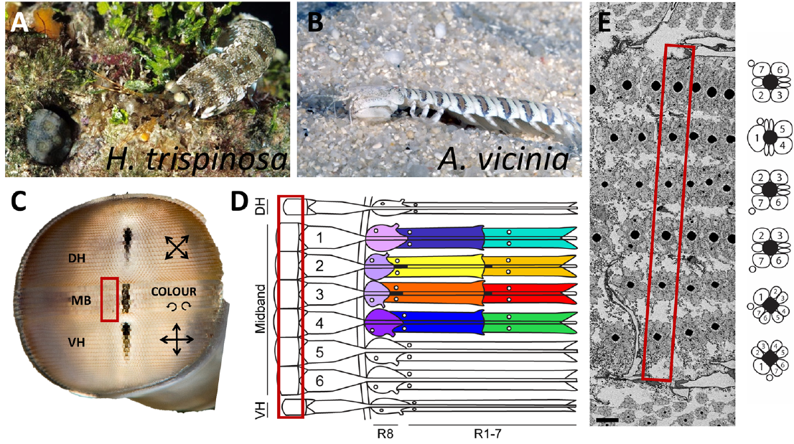
Midband rows separate spectral and polarization inputs
The midband is the specialized strip of enlarged ommatidia separating the eye's hemispheres. In Haptosquilla trispinosa, its first four rows carry differently tuned spectral receptors; the last two rows participate in circular or elliptical polarization sensing.
Thoen and colleagues recorded eight visible-sensitive receptor classes and three ultraviolet-sensitive classes; another ultraviolet class was difficult to locate. Streets and colleagues mapped the six-row retinal organization with serial electron microscopy and reconstructed the associated photoreceptor projections.
Anatomical row identity and recorded sensitivity are complementary measurements. Twelve potential spectral channels in the color rows do not imply twelve independently established perceptual dimensions. Functional assignments also require species-specific evidence rather than assuming that every mantis shrimp has the same six-row system.
Thoen et al. (2014), Fig. 1(A, B). Haptosquilla eye with dorsal, ventral and color-row labels.
Streets et al. (2025), Fig. 1(A–E). Published retinal layout and electron-microscopy cross-section.
Thoen et al. (2014); Streets et al. (2025)
08
Notes:
• Each of the four color rows contains receptor populations at different optical depths. This arrangement creates multiple spectral inputs within a narrow spatial strip.
• The published physiology did not directly record every presumed ultraviolet population. That distinction matters when comparing an anatomical count with the number of measured sensitivity functions.
• Rows five and six have different optical specializations. Their signals concern polarization, so adding every receptor population into one color-channel count would combine different kinds of information.
References:
Thoen HH, How MJ, Chiou TH, Marshall J (2014). A Different Form of Color Vision in Mantis Shrimp. Science 343: 411-413. https://doi.org/10.1126/science.1245824
Streets A, England H, Marshall J (2025). Neural Repertoire Behind the World's Most Complex Retina: Neuroanatomy of the Stomatopod Lamina. Journal of Comparative Neurology 533: e70063. https://doi.org/10.1002/cne.70063
Figure: Thoen et al. (2014), Fig. 1(A, B). Haptosquilla eye with dorsal, ventral and color-row labels.
Figure source: https://doi.org/10.1126/science.1245824
Figure: Streets et al. (2025), Fig. 1(A–E). Published retinal layout and electron-microscopy cross-section.
Figure source: https://doi.org/10.1002/cne.70063

Slide 9
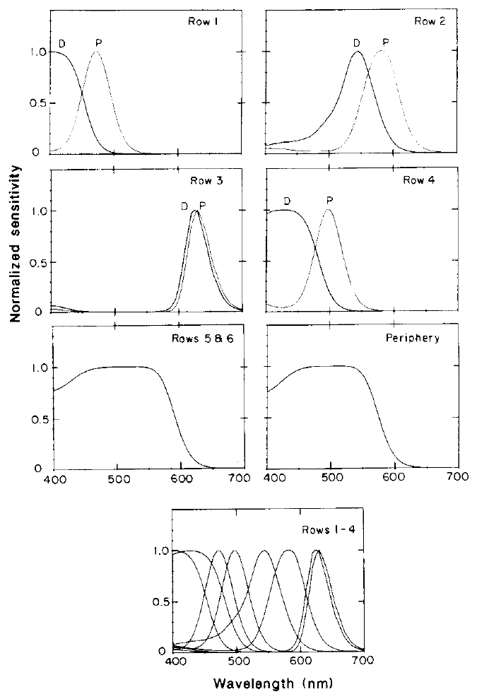
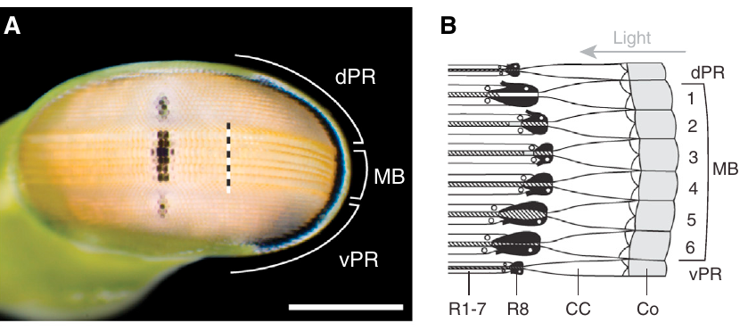
Three optical tiers place receptors at different depths
A retinular cell is a photoreceptor forming part of an ommatidium. In color midband rows, the distal R8 receptor lies nearest the incoming light, while cells R1–R7 contribute to two deeper tiers. Distal means nearer the optical entrance; proximal means farther along the light path.
Cronin and Marshall measured pigments and filters in frozen Pseudosquilla ciliata retinal sections. Each of the eight main-rhabdom tiers in rows 1–4 contained a distinct pigment. Light entering a deeper tier had already passed through the overlying material.
Tiering therefore changes both receptor position and the available spectrum. The published sensitivity curves combine measured absorption with optical assumptions; they are not direct recordings of every receptor's voltage response.
Bok et al. (2014), Fig. 1(A, B). Eye surface and original sagittal retinal diagram.
Cronin & Marshall (1989), Fig. 3. Predicted sensitivities of distal and proximal retinal tiers.
Cronin & Marshall (1989); Bok et al. (2014)
09
Notes:
• The same incoming beam encounters successive receptor-bearing layers. Absorption in an earlier layer can remove wavelengths before the light reaches a later one.
• Distal and proximal describe that order. They do not by themselves specify a receptor's preferred wavelength; the pigment and overlying filters determine the effective sensitivity.
• The study used measured optical properties to calculate sensitivities for the layered system. A calculated curve needs to be distinguished from an intracellular recording even when both concern the same retinal tier.
References:
Cronin TW, Marshall NJ (1989). A retina with at least ten spectral types of photoreceptors in a mantis shrimp. Nature 339: 137-140. https://doi.org/10.1038/339137a0
Bok MJ, Porter ML, Place AR, Cronin TW (2014). Biological Sunscreens Tune Polychromatic Ultraviolet Vision in Mantis Shrimp. Current Biology 24: 1636-1642. https://doi.org/10.1016/j.cub.2014.05.071
Figure: Cronin & Marshall (1989), Fig. 3. Predicted sensitivities of distal and proximal retinal tiers.
Figure source: https://doi.org/10.1038/339137a0
Figure: Bok et al. (2014), Fig. 1(A, B). Eye surface and original sagittal retinal diagram.
Figure source: https://doi.org/10.1016/j.cub.2014.05.071

Slide 10
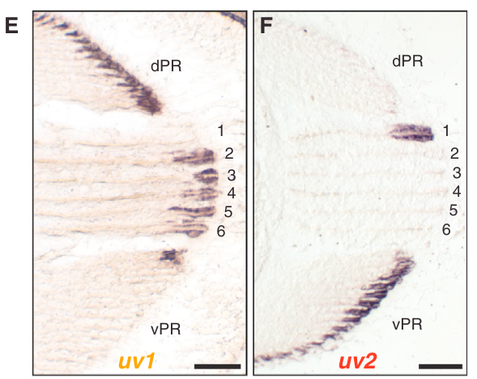
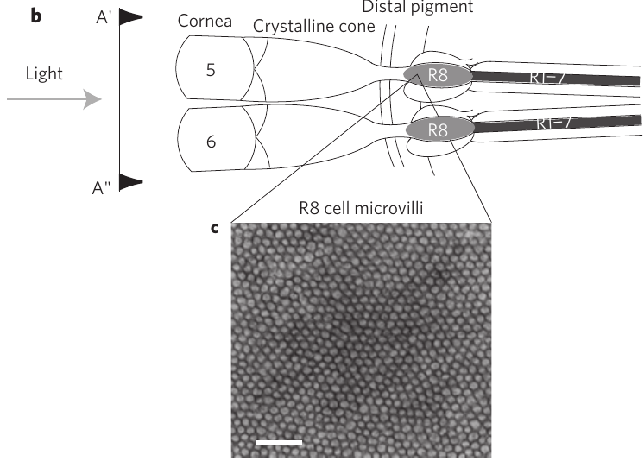
R8 combines ultraviolet reception with optical filtering
The R8 cell is the eighth retinular photoreceptor, located above the main R1–R7 rhabdom. Its optical position allows it to absorb ultraviolet photons while altering visible light transmitted toward deeper receptors. These operations depend on the row and species.
In Neogonodactylus oerstedii, Bok and colleagues localized ultraviolet opsin transcripts to R8 cells. In Odontodactylus scyllarus, Roberts and colleagues examined unusually long, ordered R8 microvilli in polarization rows 5 and 6, where the rhabdomere was approximately 150 µm long.
A rhabdomere is one cell's contribution to the light-sensitive rhabdom. R8 ultraviolet sensitivity and visible-light retardance are different properties of that structure. Neither implies that an ultraviolet electrical response is required for every visible circular-polarization signal.
Bok et al. (2014), Fig. 1(E, F). UV1 and UV2 transcript localization in retinal R8 cells.
Roberts et al. (2009), Fig. 1(b, c). Rows 5–6 R8 position and microvillar ultrastructure.
Bok et al. (2014); Roberts et al. (2009)
10
Notes:
• A light-sensitive cell can affect photons it does not absorb efficiently. Its transparent structures may change polarization before visible photons reach another cell.
• Transcript localization concerns the molecular identity of the ultraviolet pigment, whereas microscopy and optical measurements concern the geometry and transmission properties of the R8 rhabdomere.
• These measurements come from different species and answer different questions. They support a dual optical and sensory role without making every R8 cell an identical quarter-wave retarder.
References:
Bok MJ, Porter ML, Place AR, Cronin TW (2014). Biological Sunscreens Tune Polychromatic Ultraviolet Vision in Mantis Shrimp. Current Biology 24: 1636-1642. https://doi.org/10.1016/j.cub.2014.05.071
Roberts NW, Chiou TH, Marshall NJ, Cronin TW (2009). A biological quarter-wave retarder with excellent achromaticity in the visible wavelength region. Nature Photonics 3: 641-644. https://doi.org/10.1038/nphoton.2009.189
Figure: Bok et al. (2014), Fig. 1(E, F). UV1 and UV2 transcript localization in retinal R8 cells.
Figure source: https://doi.org/10.1016/j.cub.2014.05.071
Figure: Roberts et al. (2009), Fig. 1(b, c). Rows 5–6 R8 position and microvillar ultrastructure.
Figure source: https://doi.org/10.1038/nphoton.2009.189

Slide 11
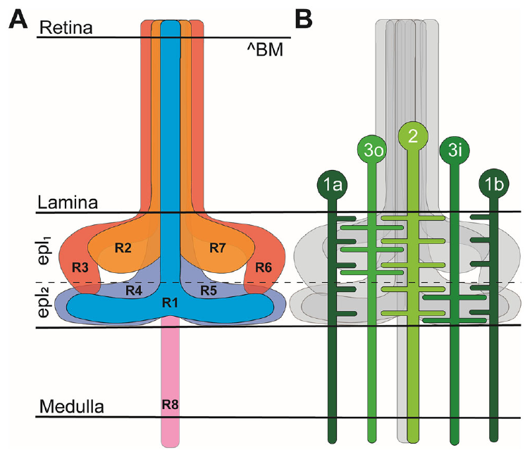
Photoreceptor axons reach distinct lamina layers
The lamina is the first optic neuropil, a region containing neuronal processes where retinal signals encounter interneurons. A lamina cartridge is the processing column associated with an ommatidium. Streets and colleagues reconstructed these columns in Haptosquilla trispinosa and Alachosquilla vicinia.
R2, R3, R6 and R7 terminals occupied the outer external plexiform layer, whereas R1, R4 and R5 occupied the inner layer. R8 axons extended through the lamina toward the medulla, the next optic neuropil. The reconstructions revised older assignments of the two receptor groups.
Layer separation preserves distinct input populations and supplies candidate sites for comparison. Terminal position alone does not establish synaptic direction, transmitter identity or an excitatory-versus-inhibitory response.
Streets et al. (2025), Fig. 2(A, B). Original reconstruction-based layout of receptor terminals and monopolar cells.
Streets et al. (2025)
11
Notes:
• An axon carries a neuron's output toward its terminal region. The reconstructed trajectories allow cells to be followed from their retinal identities into particular lamina layers.
• The two external plexiform layers contain different R1–R7 groups. R8 follows a longer route toward the medulla rather than ending with the major short visual fibers.
• The anatomical revision matters because a recording interpreted with an older layer assignment could be attributed to the wrong receptor group. The morphology still leaves the actual signs and mechanisms of transmission unresolved.
References:
Streets A, England H, Marshall J (2025). Neural Repertoire Behind the World's Most Complex Retina: Neuroanatomy of the Stomatopod Lamina. Journal of Comparative Neurology 533: e70063. https://doi.org/10.1002/cne.70063
Figure: Streets et al. (2025), Fig. 2(A, B). Original reconstruction-based layout of receptor terminals and monopolar cells.
Figure source: https://doi.org/10.1002/cne.70063

Slide 12
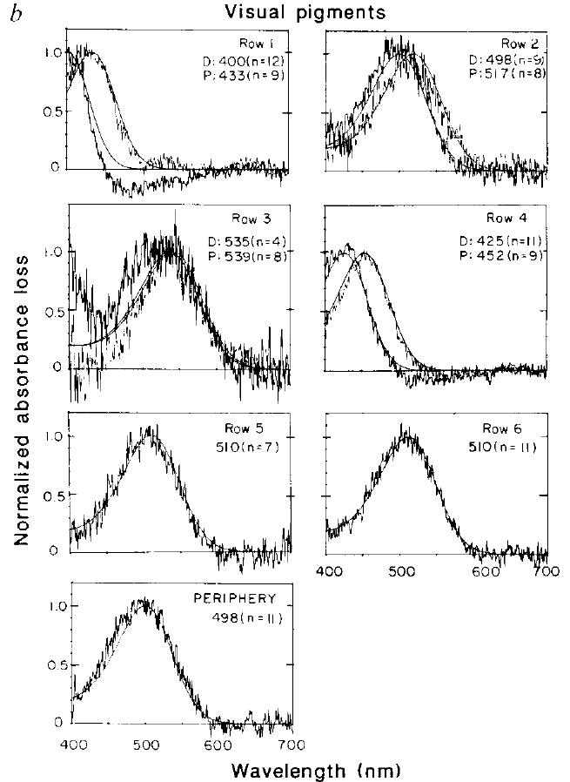
Microspectrophotometry separates pigment absorption
Microspectrophotometry measures how a microscopic specimen absorbs light across wavelengths. Cronin and Marshall directed a 1.5-µm measuring spot along the light-sensitive structures of frozen Pseudosquilla ciliata retinal sections, scanning from 400 to 700 nm.
Animals were dark-adapted before sampling. Absorption before and after strong illumination was compared in the same receptor region to isolate the light-sensitive pigment contribution. Fitted pigment peaks ranged from approximately 400 to 539 nm across the main retinal classes.
This procedure distinguishes pigment absorption from an intact cell's effective spectral sensitivity, which also depends on optical filtering and receptor length. The ultraviolet-sensitive R8 pigment was not characterized by this visible-range measurement, so its absence from these curves is not evidence that ultraviolet reception is absent.
Thoen et al. (2014), Fig. 1(A, B). Later intracellular sensitivity curves in Haptosquilla.
Cronin & Marshall (1989), Fig. 2(b). Measured visual-pigment difference spectra with fitted templates.
Cronin & Marshall (1989); Thoen et al. (2014)
12
Notes:
• The small measuring spot permits a specific retinal region to be sampled rather than averaging the entire eye. Measuring along the receptor axis follows the path taken by incoming light.
• Subtracting the post-illumination spectrum from the dark-adapted spectrum separates a changing visual pigment from more stable absorbing material. Template fitting estimates where that pigment absorbs most strongly.
• The visible-range scan cannot characterize a pigment peaking farther into the ultraviolet. An optical measurement of one component also cannot replace a voltage measurement of the intact receptor after all overlying filters have acted.
References:
Cronin TW, Marshall NJ (1989). A retina with at least ten spectral types of photoreceptors in a mantis shrimp. Nature 339: 137-140. https://doi.org/10.1038/339137a0
Thoen HH, How MJ, Chiou TH, Marshall J (2014). A Different Form of Color Vision in Mantis Shrimp. Science 343: 411-413. https://doi.org/10.1126/science.1245824
Figure: Cronin & Marshall (1989), Fig. 2(b). Measured visual-pigment difference spectra with fitted templates.
Figure source: https://doi.org/10.1038/339137a0
Figure: Thoen et al. (2014), Fig. 1(A, B). Later intracellular sensitivity curves in Haptosquilla.
Figure source: https://doi.org/10.1126/science.1245824

Slide 13
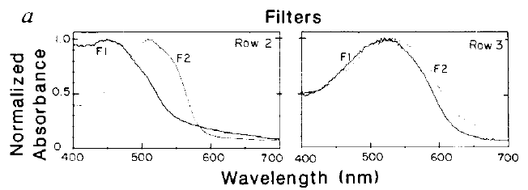
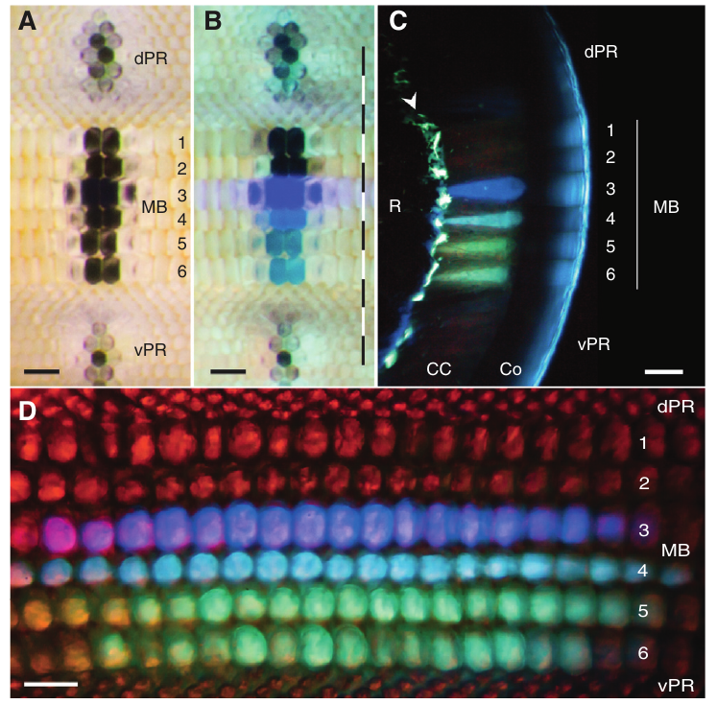
Visual pigments and stable filters are distinct components
A visual pigment is a light-absorbing chromophore bound to an opsin protein; photon absorption initiates receptor activation. An optical filter selectively removes wavelengths from the light reaching that pigment. These components can therefore change sensitivity through different mechanisms.
Cronin and Marshall measured light-sensitive pigments and comparatively stable intrarhabdomal filters separately in Pseudosquilla ciliata. Midband rows 2 and 3 contained two filters in series. Bok and colleagues later identified a distinct ultraviolet-filter system in the crystalline cones of Neogonodactylus oerstedii.
Pigment diversity and filter diversity must not be treated as interchangeable counts. Filtering can produce different effective sensitivities without adding a new functional opsin, while separate visual pigments can also contribute distinct spectral channels.
Cronin & Marshall (1989), Fig. 2(a). Absorption spectra of the distal and proximal intrarhabdomal filters.
Bok et al. (2014), Fig. 2(A–D). Native UV fluorescence localizes a separate cone-filter system.
Cronin & Marshall (1989); Bok et al. (2014)
13
Notes:
• The chromophore absorbs a photon within the receptor's visual pigment. A filter acts before that absorption by changing the spectrum transmitted farther along the optical path.
• The visible-light filters measured inside the rhabdom differ in location from the ultraviolet filters measured above it in the crystalline cones. Both alter the spectrum available to a receptor.
• A receptor's peak sensitivity is therefore a property of pigment plus optical environment. Inferring a separate opsin from every measured peak would overlook this experimentally established filtering mechanism.
References:
Cronin TW, Marshall NJ (1989). A retina with at least ten spectral types of photoreceptors in a mantis shrimp. Nature 339: 137-140. https://doi.org/10.1038/339137a0
Bok MJ, Porter ML, Place AR, Cronin TW (2014). Biological Sunscreens Tune Polychromatic Ultraviolet Vision in Mantis Shrimp. Current Biology 24: 1636-1642. https://doi.org/10.1016/j.cub.2014.05.071
Figure: Cronin & Marshall (1989), Fig. 2(a). Absorption spectra of the distal and proximal intrarhabdomal filters.
Figure source: https://doi.org/10.1038/339137a0
Figure: Bok et al. (2014), Fig. 2(A–D). Native UV fluorescence localizes a separate cone-filter system.
Figure source: https://doi.org/10.1016/j.cub.2014.05.071

Slide 14
Successive filters narrow the spectrum reaching deep tiers
Serial filtering occurs when light passes through successive absorbing structures before reaching a receptor. Cronin and Marshall measured a distal filter and a proximal filter in each of midband rows 2 and 3 in Pseudosquilla ciliata.
The distal filter transmitted a broader wavelength range than the deeper filter. The underlying receptor tiers therefore received different spectra even within one optical unit. The authors calculated effective sensitivities by combining each tier's pigment absorption with transmission through the material above it.
The resulting predicted sensitivity functions were narrower than the pigment absorption curves alone. This optical mechanism supplies selective spectral inputs; it does not establish the downstream comparison rule or prove that behavior uses every distinction available at the receptor level.
Cronin & Marshall (1989), Fig. 2(a). Distal and proximal filter spectra in rows 2 and 3.
Cronin & Marshall (1989), Fig. 3. Published calculations of sensitivity after serial filtering.
Cronin & Marshall (1989)
14
Notes:
• A deeper receptor does not receive the unmodified spectrum that entered the cornea. Some wavelengths have already been absorbed by filters and receptor pigments above it.
• The calculations follow this sequence rather than assigning each tier a sensitivity from its pigment alone. The two filters provide an additional difference between the spectra reaching successive tiers.
• Narrow optical sensitivity is evidence about the input channels. Behavioral experiments are required to determine how finely the animal discriminates those inputs, and neural experiments are required to identify the comparison mechanism.
References:
Cronin TW, Marshall NJ (1989). A retina with at least ten spectral types of photoreceptors in a mantis shrimp. Nature 339: 137-140. https://doi.org/10.1038/339137a0
Figure: Cronin & Marshall (1989), Fig. 3. Published calculations of sensitivity after serial filtering.
Figure source: https://doi.org/10.1038/339137a0
Figure: Cronin & Marshall (1989), Fig. 2(a). Distal and proximal filter spectra in rows 2 and 3.
Figure source: https://doi.org/10.1038/339137a0

Slide 15
Intracellular recordings measure effective spectral tuning
An intracellular recording measures the electrical potential inside a cell relative to the extracellular space. Thoen and colleagues used receptor recordings in Haptosquilla trispinosa to characterize the sensitivity functions supporting their discrimination analysis.
Eight measured classes peaked in the visible spectrum, and three more were recorded in the ultraviolet. The published curves are normalized to each class's maximum response, so their heights do not represent equal absolute responses to the same photon flux. An additional ultraviolet class was difficult to record.
These measurements include the consequences of the intact receptor's optical environment. They establish multiple effective spectral inputs, while leaving unresolved how channel signals are weighted, compared or recognized during a behavioral decision.
Thoen et al. (2014), Fig. 1(A, B). Receptor sensitivities measured by intracellular electrophysiology.
Thoen et al. (2014)
15
Notes:
• A receptor's response changes when stimulus wavelength changes, even if the experiment controls the amount of light. The recording links spectral stimulation to electrical activity.
• Normalization gives every class the same plotted maximum for comparison of tuning shape. It does not establish equal numbers of cells, equal gain or equal contributions to a downstream neuron.
• The incomplete ultraviolet sampling is an experimental limitation. The available curves can constrain models, but they cannot specify every central computation simply from their peaks.
References:
Thoen HH, How MJ, Chiou TH, Marshall J (2014). A Different Form of Color Vision in Mantis Shrimp. Science 343: 411-413. https://doi.org/10.1126/science.1245824
Figure: Thoen et al. (2014), Fig. 1(A, B). Receptor sensitivities measured by intracellular electrophysiology.
Figure source: https://doi.org/10.1126/science.1245824

Slide 16
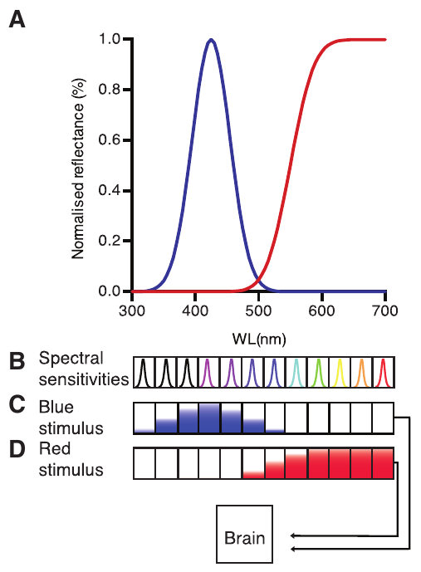
Serial color recognition remains a processing hypothesis
Color binning is the proposal that an activation pattern across discrete spectral channels identifies a color without fine analog comparisons between neighboring channels. Thoen and colleagues proposed that scanning the midband across an object could convert its spectrum into a temporal activation sequence.
Their approximately 12–25 nm behavioral thresholds were much coarser than predictions from a particular opponent model. The serial-recognition account was offered to explain that discrepancy; the study did not record a neuron decoding the proposed sequence.
Wang and Marshall's later color-versus-grey results support spectral comparison under restricted illumination. A hybrid of channel recognition and opponency is therefore plausible, but its architecture and temporal computations remain unresolved. Coarse discrimination does not justify excluding every opponent mechanism.
Thoen et al. (2014), Fig. 4(A–D). The authors’ published proposal for spectral-channel recognition.
Wang & Marshall (2025), Fig. 7. Later color-versus-grey behavior under restricted illumination.
Thoen et al. (2014); Wang & Marshall (2025)
16
Notes:
• The serial account assigns a role to receptor arrangement and scanning movements. Different spectral channels could become active in succession as the midband crosses a colored object.
• This is a proposed explanation of measured behavioral performance. The proposed spectral sequence was not measured in a neural decoder.
• The later behavioral evidence requires a more qualified account. A hybrid mechanism can accommodate more than one computation, but naming that possibility does not supply the missing recordings or connections.
References:
Thoen HH, How MJ, Chiou TH, Marshall J (2014). A Different Form of Color Vision in Mantis Shrimp. Science 343: 411-413. https://doi.org/10.1126/science.1245824
Wang CWJ, Marshall NJ (2025). Behavioural evidence of spectral opponent processing in the visual system of stomatopod crustaceans. Journal of Experimental Biology 228: jeb247952. https://doi.org/10.1242/jeb.247952
Figure: Thoen et al. (2014), Fig. 4(A–D). The authors’ published proposal for spectral-channel recognition.
Figure source: https://doi.org/10.1126/science.1245824
Figure: Wang & Marshall (2025), Fig. 7. Later color-versus-grey behavior under restricted illumination.
Figure source: https://doi.org/10.1242/jeb.247952

Slide 17
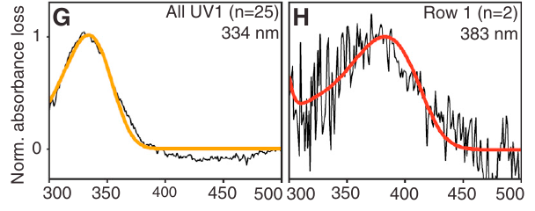
Two ultraviolet pigments support several receptor classes
Ultraviolet light has wavelengths below approximately 400 nm. Bok and colleagues investigated the several ultraviolet receptor classes of Neogonodactylus oerstedii using retinal transcript sequencing, pigment measurements and in situ hybridization, which localizes particular RNA sequences in tissue.
The uv1 transcript occupied R8 cells in midband rows 2–6, while uv2 occupied row 1 and a complementary peripheral distribution. Microspectrophotometry measured corresponding pigment peaks near 334 and 383 nm. A third transcript did not establish a third functional pigment.
The two functional pigments were insufficient by themselves to explain the receptor-class diversity. Different filters acting on the same pigment supply additional tuning. Transcript detection, pigment absorption and electrical sensitivity are distinct measurements rather than equivalent evidence of a complete sensory channel.
Bok et al. (2014), Fig. 1(E, F). Separate UV1 and UV2 transcript distributions in R8.
Bok et al. (2014), Fig. 1(G, H). Measured pigment peaks at 334 and 383 nm.
Bok et al. (2014)
17
Notes:
• An opsin transcript indicates that a cell contains RNA encoding a candidate pigment protein. In situ hybridization identifies where that sequence occurs in the retina.
• The two complementary expression patterns correspond to two measured pigment absorption peaks. The additional uv3 pattern included nuclear labeling, leading the authors to consider a possible nonfunctional gene product.
• Neither transcript number nor pigment number equals the number of effective receptor sensitivities. Optical measurements of the overlying structures explain how the same pigment can receive differently filtered ultraviolet spectra.
References:
Bok MJ, Porter ML, Place AR, Cronin TW (2014). Biological Sunscreens Tune Polychromatic Ultraviolet Vision in Mantis Shrimp. Current Biology 24: 1636-1642. https://doi.org/10.1016/j.cub.2014.05.071
Figure: Bok et al. (2014), Fig. 1(E, F). Separate UV1 and UV2 transcript distributions in R8.
Figure source: https://doi.org/10.1016/j.cub.2014.05.071
Figure: Bok et al. (2014), Fig. 1(G, H). Measured pigment peaks at 334 and 383 nm.
Figure source: https://doi.org/10.1016/j.cub.2014.05.071

Slide 18
Ultraviolet fluorescence locates crystalline-cone filters
The crystalline cone is an optical structure between the cornea and the receptor rhabdom. Bok and colleagues illuminated Neogonodactylus oerstedii eyes with 375-nm light and observed native fluorescence concentrated in particular midband rows. Fluorescence is emission following absorption of shorter-wavelength light.
Cross-sections localized the fluorescent material to the crystalline cones, directly in the path of light reaching R8. Microspectrophotometry then measured ultraviolet-absorbing pigments there. Peripheral cones and the cornea lacked comparable optically relevant ultraviolet absorption under the reported conditions.
Fluorescence provided a localization clue rather than a direct measure of receptor voltage. Absorption spectra and tissue position together support an optical-filter function; the visible fluorescent hue is not the wavelength that the underlying ultraviolet receptor necessarily detects.
Bok et al. (2014), Fig. 2(A–D). White-light view, UV fluorescence and cone-layer cross-sections.
Bok et al. (2014)
18
Notes:
• The fluorescence arises from material in the original eye specimen. The authors measured its location and absorption spectrum.
• The cone position is essential because incoming light encounters the material before reaching R8. A fluorescent substance outside the optical path would not provide the same filtering mechanism.
• The physiological consequence depends on the wavelengths absorbed and transmitted, not merely the emitted color. The authors combined fluorescence localization with absorption measurements to establish that distinction.
References:
Bok MJ, Porter ML, Place AR, Cronin TW (2014). Biological Sunscreens Tune Polychromatic Ultraviolet Vision in Mantis Shrimp. Current Biology 24: 1636-1642. https://doi.org/10.1016/j.cub.2014.05.071
Figure: Bok et al. (2014), Fig. 2(A–D). White-light view, UV fluorescence and cone-layer cross-sections.
Figure source: https://doi.org/10.1016/j.cub.2014.05.071

Slide 19
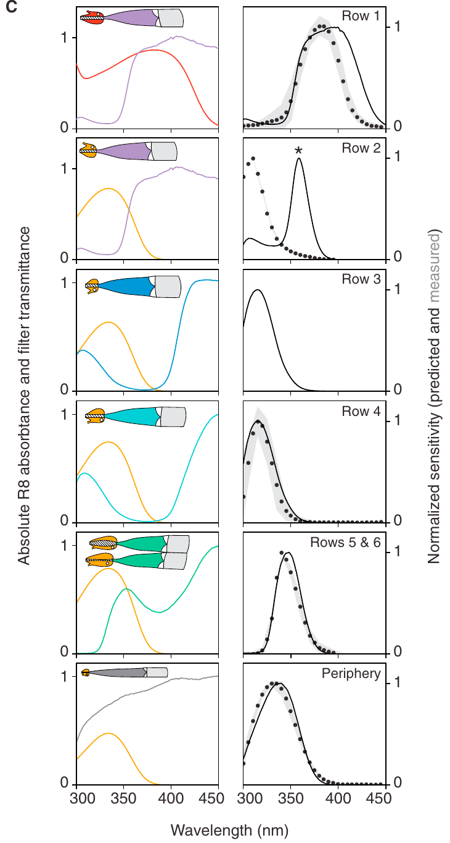
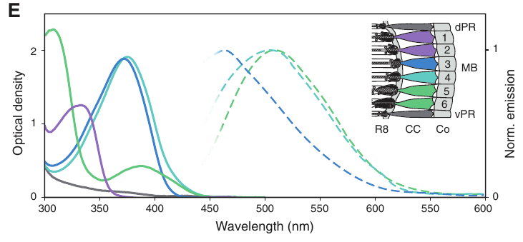
Cone filters shift ultraviolet sensitivity in both directions
A long-pass filter removes shorter wavelengths while transmitting longer ones; a short-pass filter preferentially removes longer wavelengths. Bok and colleagues combined the measured cone-filter transmission with R8 pigment absorption in Neogonodactylus oerstedii.
Row 1 filtering reduced sensitivity below about 350 nm. Filters absorbing near 372 and 375 nm in rows 3 and 4 narrowed sensitivity toward shorter ultraviolet wavelengths. Two pigments in rows 5 and 6 produced a narrow transmitted band around a predicted receptor peak of 340 nm.
Most predictions agreed with earlier electrophysiology, but row 2 differed markedly. The authors proposed an earlier row-identification error because that recorded cell lacked histological confirmation. The discrepancy remains a qualification, not a measured reassignment of the original cell.
Bok et al. (2014), Fig. 2(E). Measured absorption and emission spectra of cone pigments.
Bok et al. (2014), Fig. 3(C). Published predictions compared with measured receptor sensitivities.
Bok et al. (2014)
19
Notes:
• Filtering can shift effective sensitivity toward either shorter or longer wavelengths, depending on which photons are removed. The underlying pigment need not change.
• Combining two absorbing pigments can leave a narrow region of transmission. That mechanism differs from increasing the number of independently expressed opsins.
• The row-two disagreement limits the match between model and physiology. An explanation based on electrode localization is plausible, but the optical prediction does not retrospectively identify the cell used in an earlier recording.
References:
Bok MJ, Porter ML, Place AR, Cronin TW (2014). Biological Sunscreens Tune Polychromatic Ultraviolet Vision in Mantis Shrimp. Current Biology 24: 1636-1642. https://doi.org/10.1016/j.cub.2014.05.071
Figure: Bok et al. (2014), Fig. 3(C). Published predictions compared with measured receptor sensitivities.
Figure source: https://doi.org/10.1016/j.cub.2014.05.071
Figure: Bok et al. (2014), Fig. 2(E). Measured absorption and emission spectra of cone pigments.
Figure source: https://doi.org/10.1016/j.cub.2014.05.071

Slide 20
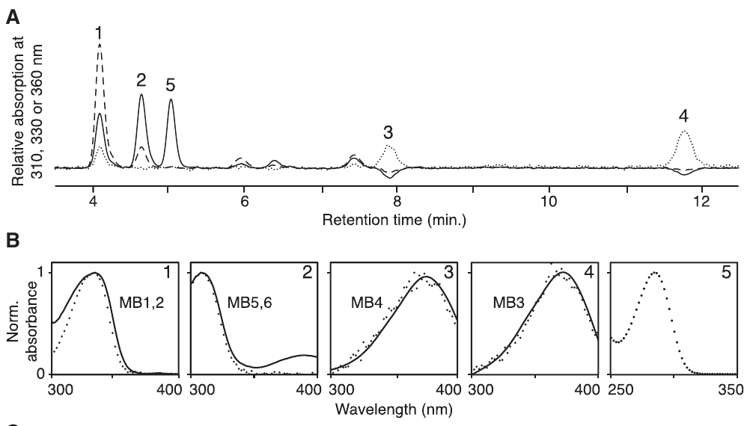
Chemical analysis identifies sunscreen-derived filters
Mycosporine-like amino acids are small ultraviolet-absorbing compounds often associated with biological photoprotection. Bok and colleagues extracted cone pigments from Neogonodactylus oerstedii and used chromatography and mass spectrometry to separate them and examine their molecular properties.
The extracts contained several ultraviolet-absorbing peaks. Two matched the compounds porphyra-334 and mycosporine-gly, consistent with filter absorption near 334 and 308 nm. Other pigments resembled members of the same chemical family, but their complete structures were unresolved.
Molecules associated with sunscreen protection can thus contribute to spectral tuning when positioned before a receptor. The proposed dietary acquisition and subsequent modification of these compounds were not directly established. The study identifies optical and chemical components without explaining every step of pigment transport or biosynthesis.
Bok et al. (2014), Fig. 4(A, B). Chromatographic peaks and absorption spectra of extracted UV pigments.
Bok et al. (2014), Fig. 2(A–D). The cone structures containing the measured pigments.
Bok et al. (2014)
20
Notes:
• Chromatography separates components of a mixture, while mass spectrometry constrains molecular identity from mass-related measurements. The agreement with cone absorption spectra connects the extracts to the optical filters.
• Two named compounds have a stronger identification than the additional proposed members of the chemical family. Their different absorption spectra can alter which ultraviolet wavelengths reach R8.
• A compound's known role in protection does not prevent it from acquiring a sensory role in another location. The acquisition, modification and placement mechanisms remain separate biological questions.
References:
Bok MJ, Porter ML, Place AR, Cronin TW (2014). Biological Sunscreens Tune Polychromatic Ultraviolet Vision in Mantis Shrimp. Current Biology 24: 1636-1642. https://doi.org/10.1016/j.cub.2014.05.071
Figure: Bok et al. (2014), Fig. 4(A, B). Chromatographic peaks and absorption spectra of extracted UV pigments.
Figure source: https://doi.org/10.1016/j.cub.2014.05.071
Figure: Bok et al. (2014), Fig. 2(A–D). The cone structures containing the measured pigments.
Figure source: https://doi.org/10.1016/j.cub.2014.05.071

Slide 21
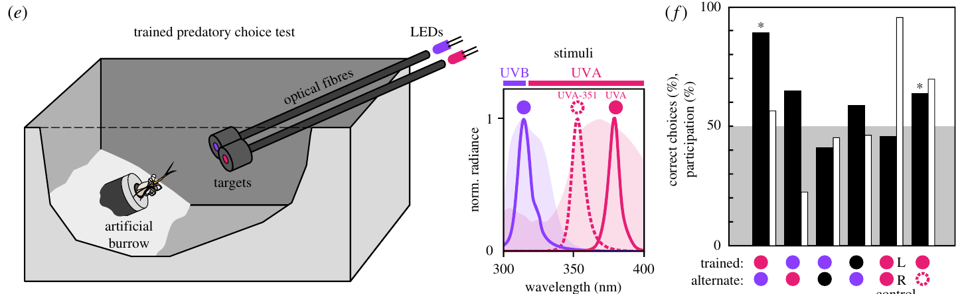
UV choices depend on wavelength beyond brightness
Bok and colleagues trained Haptosquilla trispinosa to choose ultraviolet targets delivered through optical fibers. LEDs peaked at 378.3 nm, 351.1 nm or 314.3 nm, spanning long- and short-wavelength portions of the ultraviolet range. Target positions varied, and relative brightness was changed across tests.
Animals trained to the 378.3-nm target selected it over the 314.3-nm target in about 90% of choices. They also distinguished 378.3 from 351.1 nm, a separation of 27.2 nm. Identical-target tests did not produce a consistent side preference.
Wavelength-dependent choices persisted despite the brightness manipulations, supporting ultraviolet spectral discrimination. Training to the short-wavelength ultraviolet target was much less successful, so the results do not imply symmetric learning or equal behavioral value across every ultraviolet channel.
Bok et al. (2018), Fig. 1(e, f). Original trained-choice apparatus, LED spectra and responses.
Bok et al. (2018)
21
Notes:
• The two ultraviolet comparisons test different separations: one spans the UVB-to-UVA range, while the other stays within UVA. The latter establishes discrimination between two nearby ultraviolet stimuli.
• Brightness variation weakens an explanation based only on the intensity of one target, and identical targets test a residual preference for one side of the apparatus.
• Learning performance depends on which stimulus is rewarded. Poor training to UVB therefore cannot be equated with an inability to detect it, especially when participation changes in its presence.
References:
Bok MJ, Roberts NW, Cronin TW (2018). Behavioural evidence for polychromatic ultraviolet sensitivity in mantis shrimp. Proceedings of the Royal Society B: Biological Sciences 285: 20181384. https://doi.org/10.1098/rspb.2018.1384
Figure: Bok et al. (2018), Fig. 1(e, f). Original trained-choice apparatus, LED spectra and responses.
Figure source: https://doi.org/10.1098/rspb.2018.1384

Slide 22
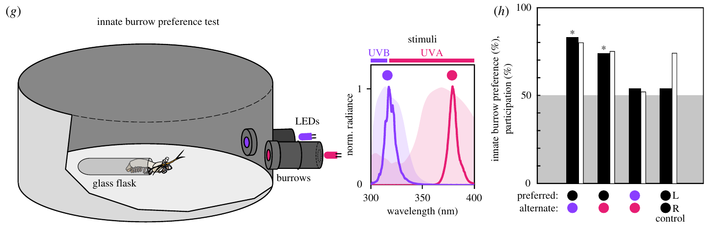
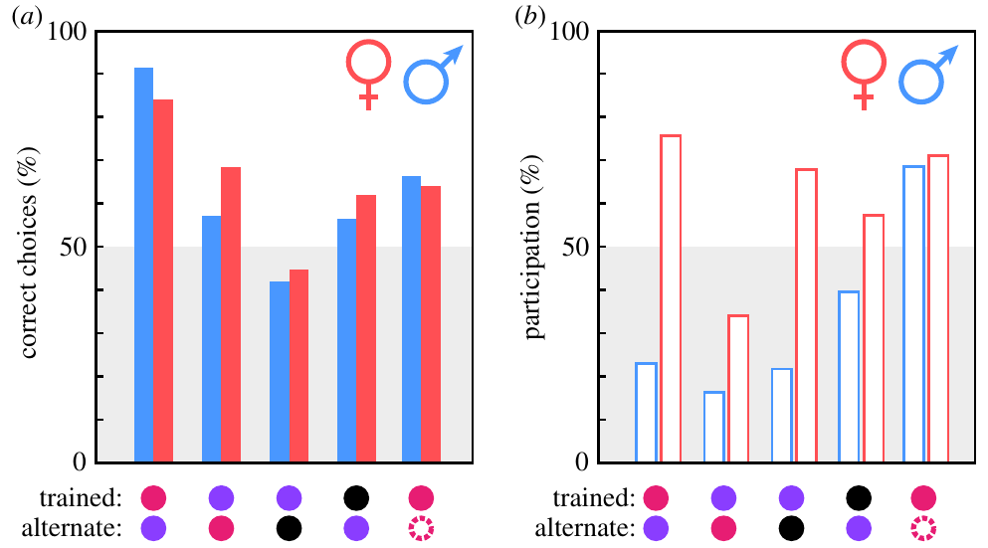
Burrow choice separates detection from approach
An innate preference assay measures an untrained choice rather than a response acquired through reward. Bok and colleagues offered Haptosquilla trispinosa two artificial burrows with dark or ultraviolet-illuminated entrances and measured which burrow the animal entered.
Dark burrows were selected over ultraviolet-illuminated burrows in roughly three-quarters or more of choices. When the alternatives were brightness-matched UVA and UVB burrows, the animals did not show a clear preference for one wavelength. Dark-versus-dark trials controlled for side preference.
Trained approach and untrained shelter selection therefore have different outcomes. Reduced participation, especially with UVB present, further separates willingness to respond from discrimination accuracy. The results support stimulus-dependent avoidance without identifying a neural aversion pathway or proving a particular natural communication function.
Bok et al. (2018), Fig. 1(g, h). Original innate burrow-choice apparatus and behavioral responses.
Bok et al. (2018), Fig. 2(a, b). Correct choices and participation differ across stimulus conditions.
Bok et al. (2018)
22
Notes:
• Rewarded targets and shelter entrances impose different behavioral demands. The same detectable stimulus can support a trained choice while being avoided in an untrained shelter task.
• The dark comparison identifies avoidance of illumination, whereas the intensity-matched UVA-versus-UVB comparison asks whether the animals prefer one illuminated shelter over the other. Those are distinct questions.
• A nonparticipating animal supplies no discrimination choice. The reduced participation should therefore be interpreted as part of the behavioral response rather than counted as direct evidence that a receptor failed to detect the stimulus.
References:
Bok MJ, Roberts NW, Cronin TW (2018). Behavioural evidence for polychromatic ultraviolet sensitivity in mantis shrimp. Proceedings of the Royal Society B: Biological Sciences 285: 20181384. https://doi.org/10.1098/rspb.2018.1384
Figure: Bok et al. (2018), Fig. 1(g, h). Original innate burrow-choice apparatus and behavioral responses.
Figure source: https://doi.org/10.1098/rspb.2018.1384
Figure: Bok et al. (2018), Fig. 2(a, b). Correct choices and participation differ across stimulus conditions.
Figure source: https://doi.org/10.1098/rspb.2018.1384

Slide 23
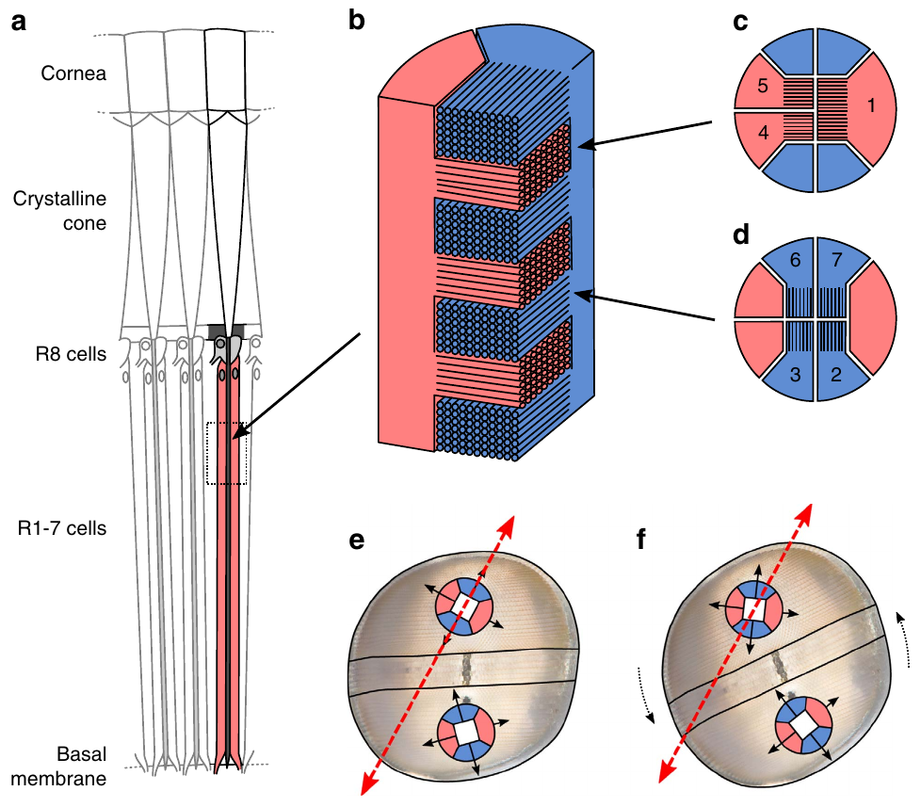
Linear polarization adds information beyond wavelength
Polarization describes the organization of a light wave's electric-field oscillation. In linearly polarized light, the electric vector oscillates along one orientation. Two lights can share a wavelength spectrum and intensity while differing in polarization orientation.
Stomatopod photoreceptors contain ordered microvilli, tiny membrane projections that organize the light-sensitive pigment. Their response depends on the angle between the electric vector and the microvillar axes. Daly and colleagues related this geometry to measured eye movements in polarized stimulus fields.
Polarization sensing is therefore distinct from spectral discrimination. A visual response to orientation requires the appropriate receptor geometry and subsequent signal processing; it must not be inferred simply from the presence of many color-sensitive receptor classes.
Daly et al. (2016), Fig. 2(a–f). The authors’ published receptor geometry for linear-polarization sampling.
Chiou et al. (2008); Kleinlogel & White (2008); Daly et al. (2016)
23
Notes:
• Wavelength and polarization describe different physical properties of light. Equal spectral content does not require equal electric-vector orientation.
• Aligned microvillar membranes provide a directional organization for photon absorption. A receptor can respond differently when the polarizer rotates even if the stimulus remains at the same wavelengths.
• The published anatomical arrangement supplies the receptor axes used in the eye-movement analysis. It does not by itself determine how a central neuron separates polarization from changes in intensity.
References:
Chiou TH, Kleinlogel S, Cronin T, Caldwell R, Loeffler B, Siddiqi A, Goldizen A, Marshall J (2008). Circular Polarization Vision in a Stomatopod Crustacean. Current Biology 18: 429-434. https://doi.org/10.1016/j.cub.2008.02.066
Kleinlogel S, White AG (2008). The Secret World of Shrimps: Polarisation Vision at Its Best. PLoS ONE 3: e2190. https://doi.org/10.1371/journal.pone.0002190
Daly IM, How MJ, Partridge JC, Temple SE, Marshall NJ, Cronin TW, Roberts NW (2016). Dynamic polarization vision in mantis shrimps. Nature Communications 7: 12140. https://doi.org/10.1038/ncomms12140
Figure: Daly et al. (2016), Fig. 2(a–f). The authors’ published receptor geometry for linear-polarization sampling.
Figure source: https://doi.org/10.1038/ncomms12140

Slide 24
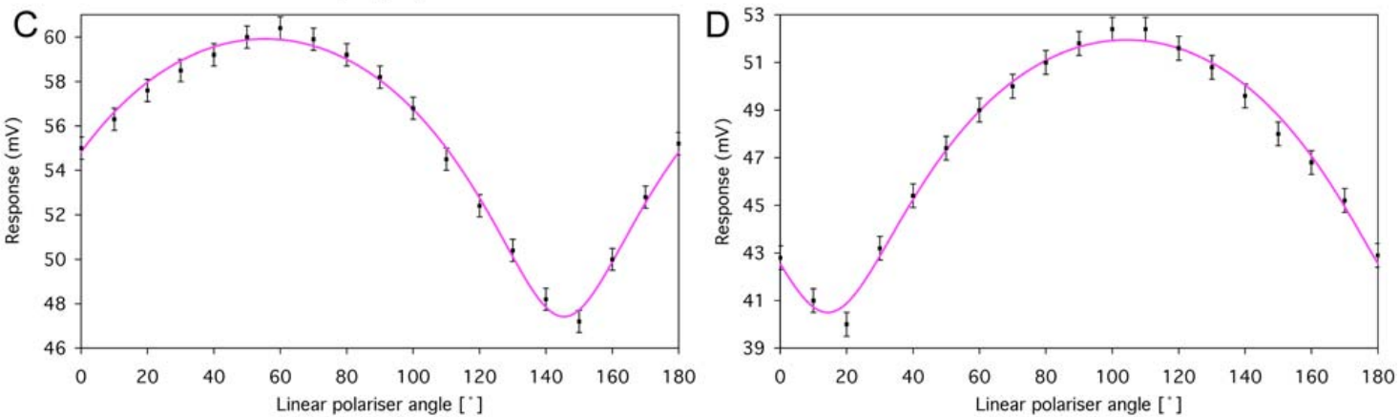
Microvillar orientation determines linear-polarization tuning
Polarization tuning is a response dependence on the electric-vector orientation of the stimulus. Kleinlogel and White recorded identified Gonodactylus smithii photoreceptors while rotating a linear polarizer in 10° steps. The recorded peaks followed the cells' microvillar orientation.
Representative dorsal and ventral R1 cells reached their largest responses at approximately 60° and 105° in the experiment's coordinates, a separation of 45°. Within an ommatidium, the complementary receptor group has an approximately orthogonal preferred axis.
The tuning curves establish directional receptor sensitivity under controlled stimulation. The plotted angles depend on eye and apparatus orientation; they are not universal horizontal and vertical preferences fixed to the world. Nonzero responses at unfavorable angles also limit any claim of perfect polarization selectivity.
Kleinlogel & White (2008), Fig. 4(C, D). Dorsal and ventral receptor voltage as the polarizer angle changes.
Daly et al. (2016), Fig. 2(a–f). Original geometry of alternating microvillar directions.
Kleinlogel & White (2008); Daly et al. (2016)
24
Notes:
• The polarizer changes electric-vector orientation while receptor voltage is recorded. A tuning maximum identifies the stimulus axis producing the strongest response in those experimental coordinates.
• The dorsal and ventral examples differ by forty-five degrees, providing offset sampling axes across the eye. The complementary receptors within each unit add another ninety-degree separation.
• A cell still responds at its unfavorable orientation because selectivity is finite. Both orientation and intensity influence voltage, which is why a single response amplitude cannot uniquely identify the incoming polarization state.
References:
Kleinlogel S, White AG (2008). The Secret World of Shrimps: Polarisation Vision at Its Best. PLoS ONE 3: e2190. https://doi.org/10.1371/journal.pone.0002190
Daly IM, How MJ, Partridge JC, Temple SE, Marshall NJ, Cronin TW, Roberts NW (2016). Dynamic polarization vision in mantis shrimps. Nature Communications 7: 12140. https://doi.org/10.1038/ncomms12140
Figure: Kleinlogel & White (2008), Fig. 4(C, D). Dorsal and ventral receptor voltage as the polarizer angle changes.
Figure source: https://doi.org/10.1371/journal.pone.0002190
Figure: Daly et al. (2016), Fig. 2(a–f). Original geometry of alternating microvillar directions.
Figure source: https://doi.org/10.1038/ncomms12140

Slide 25
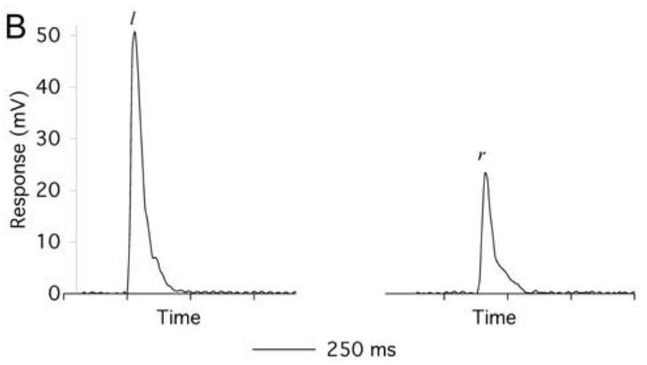
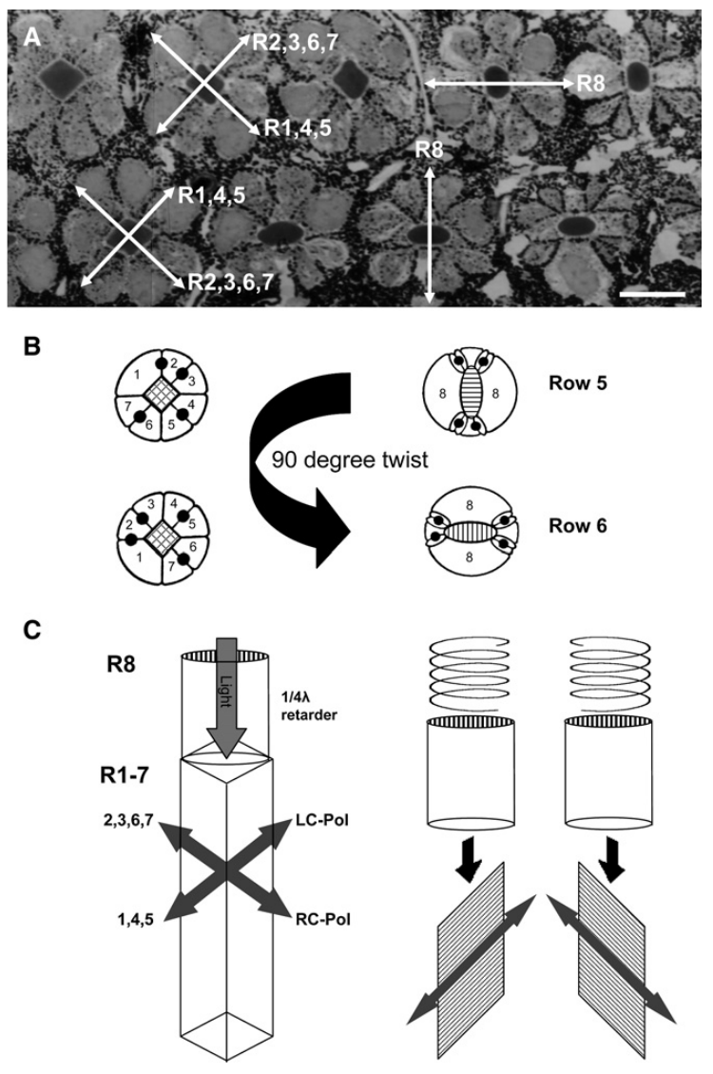
Brief flashes link polarization state to receptor voltage
A receptor potential is a stimulus-dependent change in photoreceptor membrane voltage. Kleinlogel and White delivered 50-ms polarized flashes while a sharp electrode recorded Gonodactylus smithii cells. Linear and circular polarizing elements controlled the incident polarization.
A midband row-5 receptor produced different voltage responses to left- and right-circularly polarized flashes. Peak responses were used for intensity-response measurements. Histological identification after dye injection linked physiological responses to particular retinal cells.
The voltage difference establishes receptor-level sensitivity, not a behavioral choice or an independently isolated circular-polarization receptor molecule. The incident light is transformed by the overlying R8 structure before reaching the main rhabdom, so the measured response belongs to the combined optical and receptor system.
Kleinlogel & White (2008), Fig. 4(B). Different voltage responses to opposite circular states after 50-ms flashes.
Chiou et al. (2008), Fig. 2(A–C). Original anatomy of the overlying R8 and R1–R7 system.
Kleinlogel & White (2008); Chiou et al. (2008)
25
Notes:
• The short flash provides a defined stimulation interval, and the electrode records the resulting voltage over time. Comparing two polarization states in the same cell reduces ambiguity from differences between cells.
• Dye filling supplies an anatomical check on recording identity. That check is stronger than assigning a receptor solely from electrode depth or response shape.
• The receptor's membrane absorbs the light after the retinal optics have acted. A sensitivity to circular incident light can therefore arise from optical conversion followed by ordinary linear-polarization-sensitive absorption.
References:
Kleinlogel S, White AG (2008). The Secret World of Shrimps: Polarisation Vision at Its Best. PLoS ONE 3: e2190. https://doi.org/10.1371/journal.pone.0002190
Chiou TH, Kleinlogel S, Cronin T, Caldwell R, Loeffler B, Siddiqi A, Goldizen A, Marshall J (2008). Circular Polarization Vision in a Stomatopod Crustacean. Current Biology 18: 429-434. https://doi.org/10.1016/j.cub.2008.02.066
Figure: Kleinlogel & White (2008), Fig. 4(B). Different voltage responses to opposite circular states after 50-ms flashes.
Figure source: https://doi.org/10.1371/journal.pone.0002190
Figure: Chiou et al. (2008), Fig. 2(A–C). Original anatomy of the overlying R8 and R1–R7 system.
Figure source: https://doi.org/10.1016/j.cub.2008.02.066

Slide 26
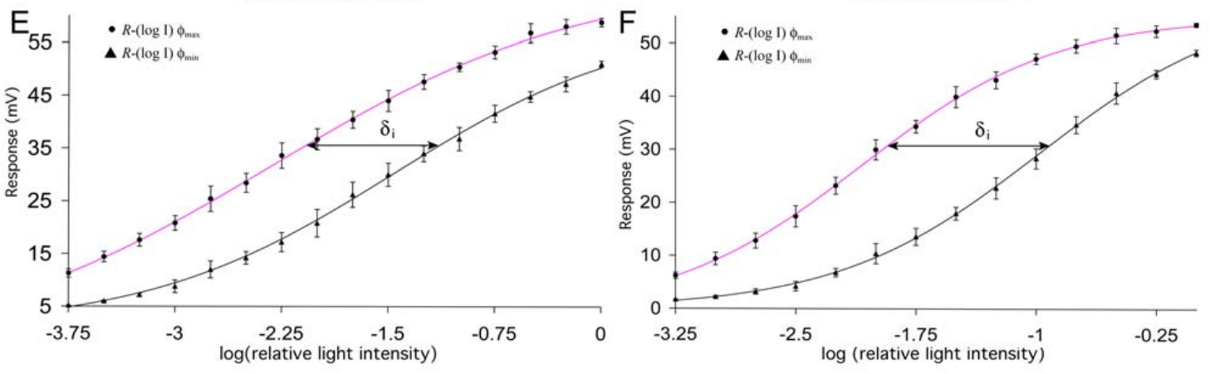
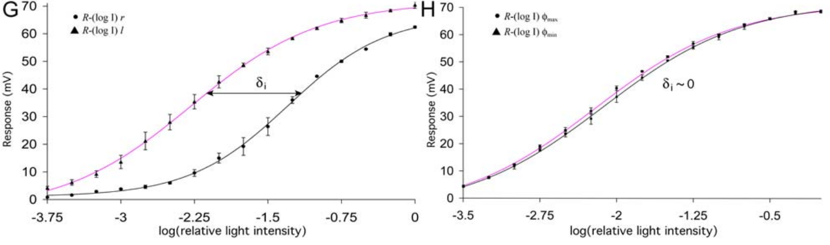
Intensity curves separate gain from polarization preference
Polarization sensitivity can be estimated by comparing the light intensities needed for equal voltage responses under preferred and unfavorable polarization states. Kleinlogel and White measured intensity-response functions in Gonodactylus smithii, rather than using one response at a single intensity.
Hemispheric receptors required about an order-of-magnitude intensity difference between favorable and orthogonal linear orientations to produce comparable responses. Midband rows 5 and 6 similarly distinguished opposite circular states. Their linear-polarization intensity-response curves were nearly coincident under the tested conditions.
A shifted curve reflects differential sensitivity, whereas increasing voltage within either curve reflects intensity dependence. These measurements constrain the inputs available for neural comparison. They do not directly establish an opponent interneuron, its synapses or the animal's threshold for a behavioral polarization choice.
Kleinlogel & White (2008), Fig. 4(E, F). Intensity-response functions for preferred and orthogonal linear states.
Kleinlogel & White (2008), Fig. 4(G, H). Circular-state preference and weak residual linear preference in midband cells.
Kleinlogel & White (2008)
26
Notes:
• Voltage amplitude depends on both photon delivery and polarization preference. Measuring a series of intensities permits those contributions to be separated more clearly than one flash alone.
• A sensitivity difference appears as a horizontal displacement between intensity-response functions. When two functions coincide, the tested states require similar intensities for the same response.
• The downstream comparison can use these inputs, but its existence and response sign need separate measurements. A receptor-level sensitivity ratio is therefore different from a behavioral discrimination threshold.
References:
Kleinlogel S, White AG (2008). The Secret World of Shrimps: Polarisation Vision at Its Best. PLoS ONE 3: e2190. https://doi.org/10.1371/journal.pone.0002190
Figure: Kleinlogel & White (2008), Fig. 4(E, F). Intensity-response functions for preferred and orthogonal linear states.
Figure source: https://doi.org/10.1371/journal.pone.0002190
Figure: Kleinlogel & White (2008), Fig. 4(G, H). Circular-state preference and weak residual linear preference in midband cells.
Figure source: https://doi.org/10.1371/journal.pone.0002190

Slide 27
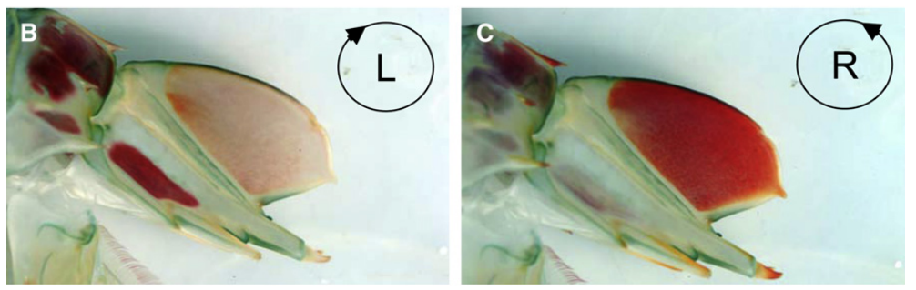
Circular handedness can alter cuticular visual signals
In circularly polarized light, the electric-vector orientation rotates as the wave propagates. Opposite rotations define the two handedness states. Their distinction depends on a specified viewing convention; it is different from changing the angle of a linearly polarized stimulus.
Chiou and colleagues photographed male Odontodactylus cuticle through opposite circular-polarization analyzers. A telson region changed strongly in apparent contrast between the two analyzer states. The telson is the posterior body plate, often presented during stomatopod displays.
This optical measurement identifies a potential circular-polarization signal on the animal. It does not establish which social decision the signal controls. The proposed private communication role remains an ecological interpretation, whereas the state-dependent reflected contrast is measured evidence.
Chiou et al. (2008), Fig. 1(B, C). The same male telson region viewed through opposite circular analyzers.
Chiou et al. (2008)
27
Notes:
• Two opposite circular states differ in handedness even though neither has one fixed electric-vector axis. A circular analyzer preferentially transmits one of those states.
• The photographed telson is the same biological region under two analyzing conditions. Its changing appearance concerns the reflected light rather than a pigment changing color between exposures.
• A visible signal and a possible display context are not sufficient to establish a communication function. Behavioral manipulation of the natural signal would be required to assign its role in a particular social interaction.
References:
Chiou TH, Kleinlogel S, Cronin T, Caldwell R, Loeffler B, Siddiqi A, Goldizen A, Marshall J (2008). Circular Polarization Vision in a Stomatopod Crustacean. Current Biology 18: 429-434. https://doi.org/10.1016/j.cub.2008.02.066
Figure: Chiou et al. (2008), Fig. 1(B, C). The same male telson region viewed through opposite circular analyzers.
Figure source: https://doi.org/10.1016/j.cub.2008.02.066

Slide 28
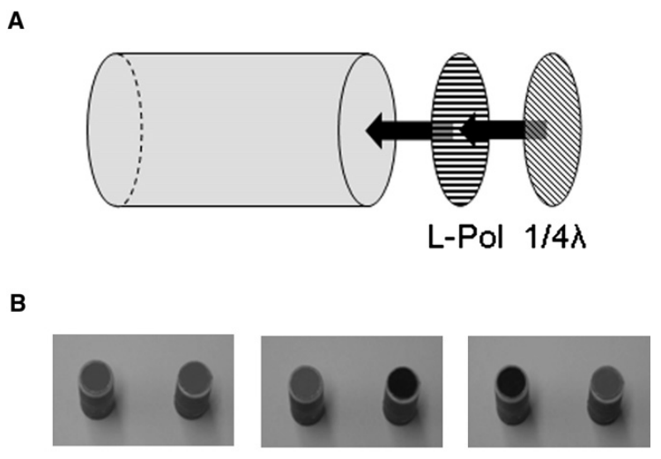
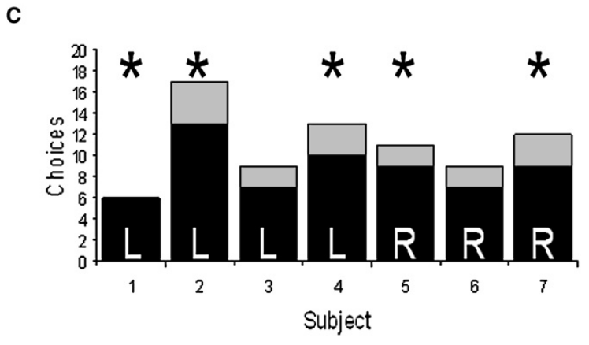
Rewarded choices establish circular-state discrimination
Operant conditioning associates an animal's action with a consequence. Chiou and colleagues trained Odontodactylus scyllarus to select feeding tubes reflecting either left- or right-circularly polarized light. Food was placed at the open end during training.
Test tubes were presented without food, with the reflecting end facing the animal. Their construction combined a linear polarizer, a quarter-wave retarder and a reflective backing. Trained animals preferentially selected the circular state associated with reward, rather than choosing only by the unfiltered appearance of the tubes.
The choices establish behavioral discrimination of circular handedness in this task. They go beyond receptor sensitivity while remaining distinct from a demonstration of natural mate recognition, signaling function or the complete neural pathway producing the choice.
Chiou et al. (2008), Fig. 5(A, B). Published feeding-tube construction and opposite-analyzer photographs.
Chiou et al. (2008), Fig. 5(C). Individual tube choices after training to circular handedness.
Chiou et al. (2008)
28
Notes:
• The apparatus assigns a food consequence to one of two circularly reflecting targets. Removing food during the test reduces direct food-associated cues at the time of choice.
• The published analyzer photographs document the optical difference between the target ends. Without a circular analyzer, the targets have similar visible appearance.
• Learned preference establishes that the available polarization information can guide action. It does not establish that the same target structure or learning contingency occurs in the natural environment.
References:
Chiou TH, Kleinlogel S, Cronin T, Caldwell R, Loeffler B, Siddiqi A, Goldizen A, Marshall J (2008). Circular Polarization Vision in a Stomatopod Crustacean. Current Biology 18: 429-434. https://doi.org/10.1016/j.cub.2008.02.066
Figure: Chiou et al. (2008), Fig. 5(A, B). Published feeding-tube construction and opposite-analyzer photographs.
Figure source: https://doi.org/10.1016/j.cub.2008.02.066
Figure: Chiou et al. (2008), Fig. 5(C). Individual tube choices after training to circular handedness.
Figure source: https://doi.org/10.1016/j.cub.2008.02.066

Slide 29
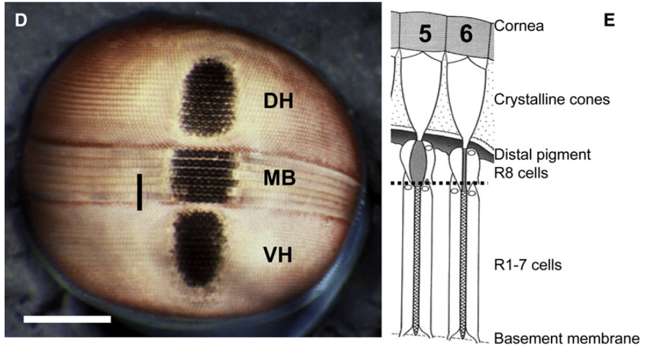
R8 transforms circular states into orthogonal linear inputs
A quarter-wave retarder introduces a relative phase delay of one-quarter wavelength, or 90°, between orthogonal electric-field components. In Odontodactylus midband rows 5 and 6, an ordered R8 rhabdomere lies above two orthogonal R1–R7 receptor groups.
R8 microvilli are oriented about 45° relative to the underlying absorption axes. Circular states of opposite handedness are converted into linear states at mutually orthogonal angles. The underlying receptor groups can then respond differently through their ordinary directional absorption.
The mechanism links tissue geometry to receptor voltage without requiring a circular-selective pigment. Its optical effectiveness depends on retardance and wavelength. Similar-looking R8 structures in other stomatopods must not be assumed to provide identical conversion without species-specific optical or physiological measurements.
Chiou et al. (2008), Fig. 2(A–C). Unchanged published anatomy and quarter-wave conversion mechanism.
Chiou et al. (2008), Fig. 1(D, E). Location of polarization rows and their optical tiers.
Chiou et al. (2008); Roberts et al. (2009)
29
Notes:
• Phase describes the timing relationship between two oscillating components of the light wave. Retarding one component changes the combined polarization state without requiring absorption of the entire beam.
• The forty-five-degree relationship places the two converted linear states along different underlying receptor axes. That geometry permits opposite circular incident states to produce different receptor responses.
• The arrangement must operate with an appropriate phase delay at the wavelengths transmitted. Anatomical resemblance alone cannot prove that another species has the same broadband optical performance.
References:
Chiou TH, Kleinlogel S, Cronin T, Caldwell R, Loeffler B, Siddiqi A, Goldizen A, Marshall J (2008). Circular Polarization Vision in a Stomatopod Crustacean. Current Biology 18: 429-434. https://doi.org/10.1016/j.cub.2008.02.066
Roberts NW, Chiou TH, Marshall NJ, Cronin TW (2009). A biological quarter-wave retarder with excellent achromaticity in the visible wavelength region. Nature Photonics 3: 641-644. https://doi.org/10.1038/nphoton.2009.189
Figure: Chiou et al. (2008), Fig. 2(A–C). Unchanged published anatomy and quarter-wave conversion mechanism.
Figure source: https://doi.org/10.1016/j.cub.2008.02.066
Figure: Chiou et al. (2008), Fig. 1(D, E). Location of polarization rows and their optical tiers.
Figure source: https://doi.org/10.1016/j.cub.2008.02.066

Slide 30
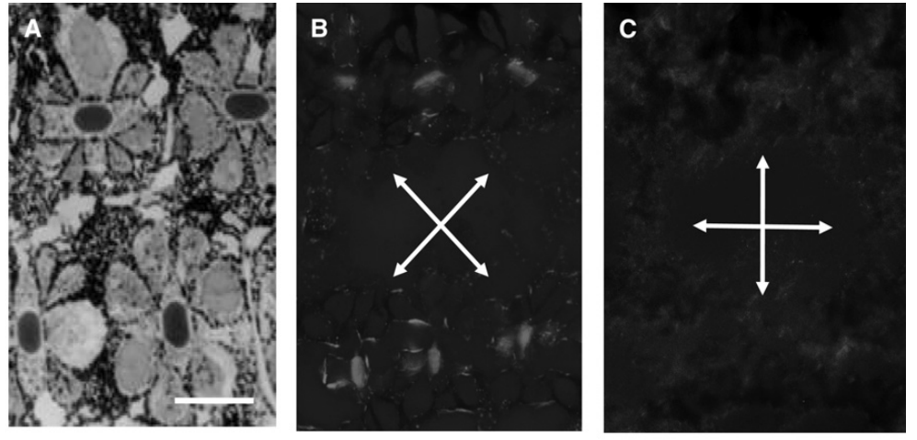
Ordered microvilli produce optical birefringence
Birefringence is a difference in refractive behavior for orthogonal polarization components. A refractive index describes how light propagates through a material relative to vacuum. Roberts and colleagues examined the ordered R8 membrane structure of Odontodactylus scyllarus.
Electron microscopy gave microvillar inner and outer radii of approximately 26 and 40 nm. These dimensions are much smaller than visible wavelengths. Polarizing-microscope observations from Chiou and colleagues also changed when the analyzer axes rotated relative to the tissue.
An orientation-dependent bright region between crossed polarizers supports birefringence rather than simple depolarization. It does not by itself prove a quarter-wave phase delay. Quantitative transmission measurements and receptor recordings are needed to connect the microscopic architecture with circular-state discrimination.
Roberts et al. (2009), Fig. 1(b, c). R8 tissue position and electron micrograph of its microvilli.
Chiou et al. (2008), Fig. 3(A–C). Tissue and crossed-polarizer views at different orientations.
Roberts et al. (2009); Chiou et al. (2008)
30
Notes:
• Orthogonal light components encounter different optical properties in the ordered tissue. The resulting phase difference depends on those properties and the distance traveled.
• The microvillar dimensions place the membrane pattern below the visible-light wavelength scale. Their arrangement is therefore relevant to the effective optics of the entire R8 rhabdomere.
• Rotating the polarizer system changes transmitted brightness, which tests directional optical behavior. Measuring brightness alone does not specify the exact phase delay or establish a behavioral response.
References:
Roberts NW, Chiou TH, Marshall NJ, Cronin TW (2009). A biological quarter-wave retarder with excellent achromaticity in the visible wavelength region. Nature Photonics 3: 641-644. https://doi.org/10.1038/nphoton.2009.189
Chiou TH, Kleinlogel S, Cronin T, Caldwell R, Loeffler B, Siddiqi A, Goldizen A, Marshall J (2008). Circular Polarization Vision in a Stomatopod Crustacean. Current Biology 18: 429-434. https://doi.org/10.1016/j.cub.2008.02.066
Figure: Roberts et al. (2009), Fig. 1(b, c). R8 tissue position and electron micrograph of its microvilli.
Figure source: https://doi.org/10.1038/nphoton.2009.189
Figure: Chiou et al. (2008), Fig. 3(A–C). Tissue and crossed-polarizer views at different orientations.
Figure source: https://doi.org/10.1016/j.cub.2008.02.066

Slide 31
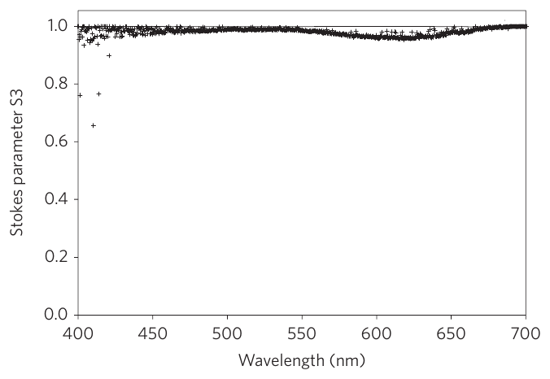
R8 conversion spans the visible spectrum
Achromaticity means that an optical operation changes relatively little with wavelength. Roberts and colleagues measured transmission through 10-µm cryosections of Odontodactylus scyllarus R8 rhabdomeres and scaled the optical measurements to the approximately 150-µm receptor length.
Light entered with linear polarization at 45° to the microvillar axis. The transmitted circular component, described by the Stokes parameter S3, remained close to that of strongly circular light across much of the 400–700 nm range. A fitted optical model reproduced this wavelength dependence.
Broadband conversion helps preserve opposite circular-state signals across the broad absorption spectrum of the underlying receptors. The curve describes optical transmission, not a receptor firing rate or measured behavioral threshold at each wavelength.
Roberts et al. (2009), Fig. 2. Measured circular component after transmission and the fitted optical model.
Roberts et al. (2009), Fig. 1(b, c). The R8 tissue whose transmission was measured.
Roberts et al. (2009)
31
Notes:
• Stokes parameters specify components of polarization. S3 represents the circular component, so its normalized magnitude can test conversion from a known linear input into circular output.
• Optical reciprocity permits the same retarding structure to convert circular input into linear output under the corresponding geometry. The measurement therefore constrains the mechanism used before R1–R7 absorption.
• The authors measured thin tissue sections and accounted for full path length. The result is a quantitative optical characterization, distinct from recording the animal's neural response across the entire tested wavelength range.
References:
Roberts NW, Chiou TH, Marshall NJ, Cronin TW (2009). A biological quarter-wave retarder with excellent achromaticity in the visible wavelength region. Nature Photonics 3: 641-644. https://doi.org/10.1038/nphoton.2009.189
Figure: Roberts et al. (2009), Fig. 2. Measured circular component after transmission and the fitted optical model.
Figure source: https://doi.org/10.1038/nphoton.2009.189
Figure: Roberts et al. (2009), Fig. 1(b, c). The R8 tissue whose transmission was measured.
Figure source: https://doi.org/10.1038/nphoton.2009.189

Slide 32
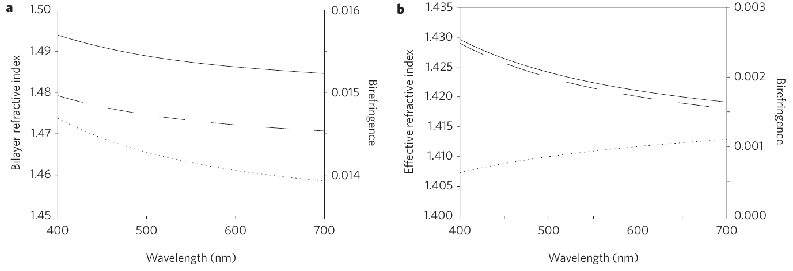
Membranes and geometry jointly shape retardance
Intrinsic birefringence arises from the material's directional optical properties. Form birefringence arises from the arrangement of different materials at small spatial scales. Roberts and colleagues modeled both contributions in the membranes and cytoplasm of the R8 rhabdomere.
The model fixed the measured microvillar dimensions and receptor length while fitting membrane refractive properties. Their interaction produced the wavelength-dependent effective birefringence needed for nearly constant quarter-wave retardance. The fitted material properties agreed with plausible membrane refractive values.
Agreement between model and transmission supports this biophysical account of the optic. It does not identify a dedicated neurotransmitter, ion channel or central comparator: the modeled operation transforms light before the downstream electrical signal is generated.
Roberts et al. (2009), Fig. 3(a, b). Published intrinsic and effective refractive-index model functions.
Roberts et al. (2009), Fig. 1(b, c). The measured microvillar geometry underlying the model.
Roberts et al. (2009)
32
Notes:
• A material can be optically directional even without a repeated structure. A repeated structure can add another directional effect when its constituent materials have different optical properties.
• In the R8 model, those contributions interact across wavelength. A nearly constant phase delay does not require every underlying refractive quantity to remain constant.
• The model is constrained by measured geometry and transmission, but some material parameters are fitted. The optical mechanism should therefore be distinguished from direct molecular identification of every membrane component or a recorded neural computation.
References:
Roberts NW, Chiou TH, Marshall NJ, Cronin TW (2009). A biological quarter-wave retarder with excellent achromaticity in the visible wavelength region. Nature Photonics 3: 641-644. https://doi.org/10.1038/nphoton.2009.189
Figure: Roberts et al. (2009), Fig. 3(a, b). Published intrinsic and effective refractive-index model functions.
Figure source: https://doi.org/10.1038/nphoton.2009.189
Figure: Roberts et al. (2009), Fig. 1(b, c). The measured microvillar geometry underlying the model.
Figure source: https://doi.org/10.1038/nphoton.2009.189

Slide 33
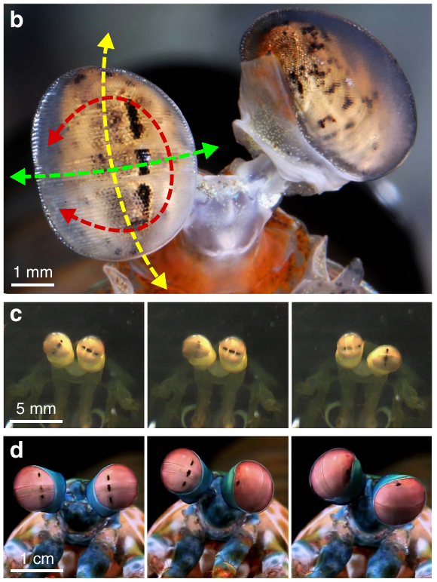
Torsion rotates the eye’s polarization-sampling axes
Torsion, or roll, rotates the eye about its viewing axis. Stomatopods can also move their eyes in pitch and yaw, changing the direction of gaze. Daly and colleagues tracked three-dimensional eye orientation in Gonodactylus smithii and Odontodactylus scyllarus.
Large torsional movements can reach approximately 90° in these species. Rolling the eye changes the orientation of its microvillar sampling axes relative to a polarized scene, even when the animal continues viewing the same object. The two eyes can move partly independently.
The movement geometry makes active polarization sampling possible. Spontaneous rotation alone does not prove that the animal maximizes a particular visual signal; controlled stimuli and measurements of the resulting receptor alignment are required to test that function.
Daly et al. (2016), Fig. 1(b–d). Published eye rotation axes and successive torsional positions.
Daly et al. (2016)
33
Notes:
• Pitch and yaw change where the eye points, while torsion changes its orientation around that direction. The distinction separates viewing direction from polarization-axis orientation.
• The original successive photographs record substantial changes in torsional position. Those movements can alter how a fixed polarized stimulus aligns with the receptor array.
• Independent movement of the two eyes also means that one eye's position cannot automatically stand for the other. The functional test must track the particular eye responding to the presented stimulus.
References:
Daly IM, How MJ, Partridge JC, Temple SE, Marshall NJ, Cronin TW, Roberts NW (2016). Dynamic polarization vision in mantis shrimps. Nature Communications 7: 12140. https://doi.org/10.1038/ncomms12140
Figure: Daly et al. (2016), Fig. 1(b–d). Published eye rotation axes and successive torsional positions.
Figure source: https://doi.org/10.1038/ncomms12140

Slide 34
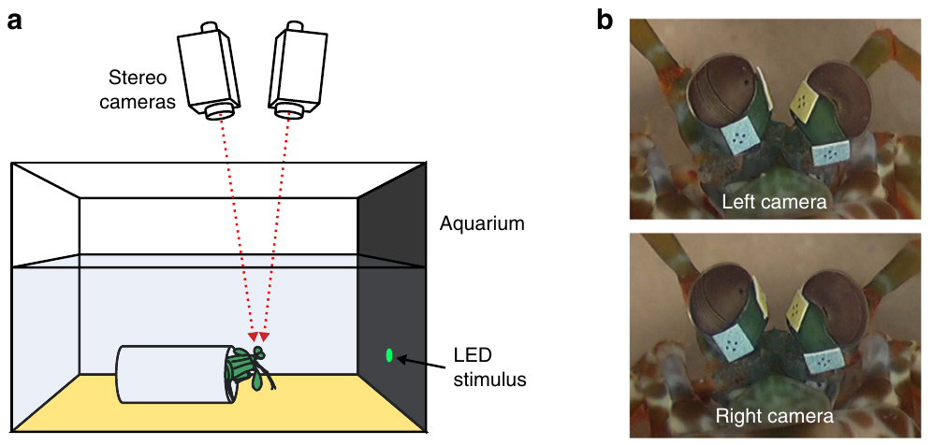
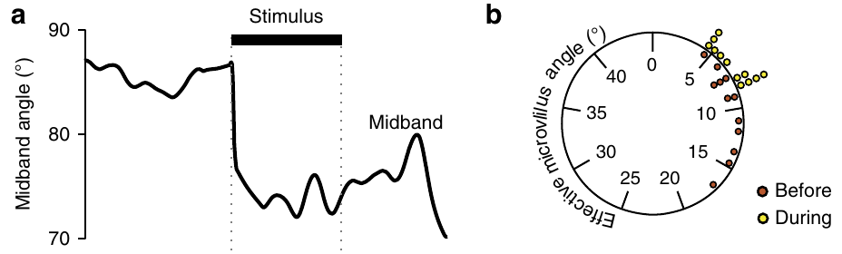
A polarized LED elicits torsional eye rotations
Daly and colleagues presented Gonodactylus smithii with a green LED peaking at 501 nm through a 4-mm aperture against a dark background. Its light was strongly linearly polarized, with either vertical or diagonal electric-vector orientation. Two cameras measured eye rotation.
The 3-s presentation commonly elicited a torsional response. Initial rotations averaged about 15°, and the responding eye moved its nearest hemispheric receptor axis toward the stimulus polarization angle. Stimulus timing and three-dimensional eye position were recorded together.
This experiment links a controlled polarized cue to measured motor output. It does not directly record the oculomotor command or identify the neurons causing the rotation. The resulting receptor alignment is derived from anatomical geometry and measured eye position.
Daly et al. (2016), Fig. 5(a, b). Original LED presentation and stereo-camera recording arrangement.
Daly et al. (2016), Fig. 3(a, b). Measured eye rotation and receptor-axis alignment during the stimulus.
Daly et al. (2016)
34
Notes:
• The green LED fixes the spectral stimulus near a wavelength detected by the relevant visible receptors. The aperture controls the spatial extent of the light source against its background.
• Stereo-camera tracking supplies orientation rather than only a two-dimensional image displacement. The temporal record aligns the eye movement with stimulus presentation.
• The nearest hemispheric sampling axis moved toward a favorable orientation. Assigning that motor response to a particular receptor-to-muscle circuit would require neural recordings or perturbations beyond this experiment.
References:
Daly IM, How MJ, Partridge JC, Temple SE, Marshall NJ, Cronin TW, Roberts NW (2016). Dynamic polarization vision in mantis shrimps. Nature Communications 7: 12140. https://doi.org/10.1038/ncomms12140
Figure: Daly et al. (2016), Fig. 5(a, b). Original LED presentation and stereo-camera recording arrangement.
Figure source: https://doi.org/10.1038/ncomms12140
Figure: Daly et al. (2016), Fig. 3(a, b). Measured eye rotation and receptor-axis alignment during the stimulus.
Figure source: https://doi.org/10.1038/ncomms12140

Slide 35
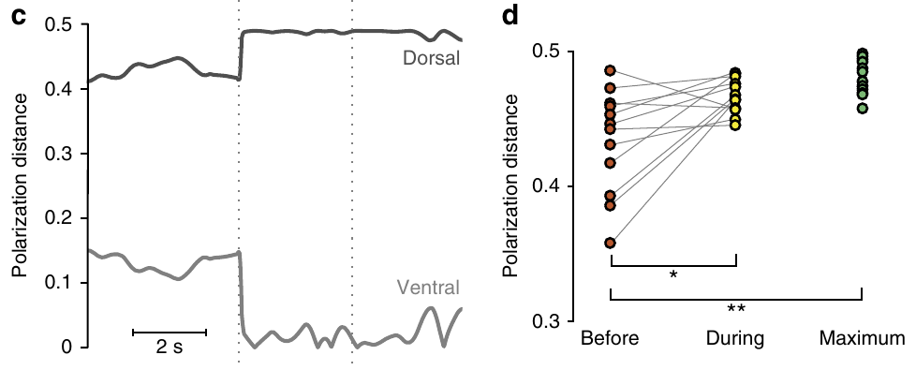
Eye positions predict increased polarization contrast
Polarization distance is a model-based measure of contrast between two polarization states available to a specified receptor system. Daly and colleagues calculated it from measured eye orientation, published receptor geometry and the polarization of the LED and its background.
During LED presentation, predicted hemispheric polarization contrast increased toward the model's favorable alignment. The dorsal and ventral receptor populations differed in their calculated contrast because their axes were offset by 45°. The movement did not similarly maximize the modeled midband polarization signal.
These results support active enhancement of a hemispheric signal. The contrast values are calculations constrained by measurements, rather than recorded interneuron voltage or proof that the animal explicitly computes the same quantity.
Daly et al. (2016), Fig. 3(c, d). Published model-based contrast estimates before and during the LED.
Daly et al. (2016), Fig. 2(a–f). Anatomical axes used in the contrast calculation.
Daly et al. (2016)
35
Notes:
• The model combines the object's polarization with the background and the receptor axes. Eye rotation changes those axes, so the predicted difference between object and background can change.
• A measured movement and a calculated contrast are different outputs. Calculated contrast depends on assumptions about receptor geometry and polarization sensitivity.
• The selective effect on hemispheric predictions limits a broad claim that torsion improves every visual channel. Color recognition and midband circular-polarization processing are not directly established by this LED contrast analysis.
References:
Daly IM, How MJ, Partridge JC, Temple SE, Marshall NJ, Cronin TW, Roberts NW (2016). Dynamic polarization vision in mantis shrimps. Nature Communications 7: 12140. https://doi.org/10.1038/ncomms12140
Figure: Daly et al. (2016), Fig. 3(c, d). Published model-based contrast estimates before and during the LED.
Figure source: https://doi.org/10.1038/ncomms12140
Figure: Daly et al. (2016), Fig. 2(a–f). Anatomical axes used in the contrast calculation.
Figure source: https://doi.org/10.1038/ncomms12140

Slide 36
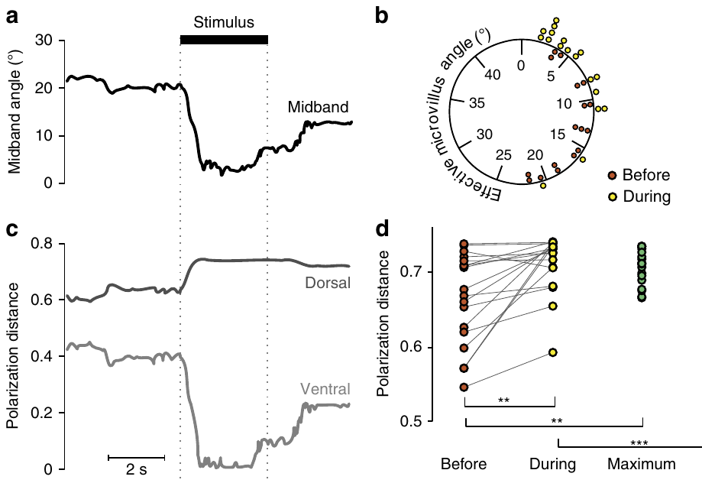
Polarized looming recruits visual sampling
A looming stimulus expands in angular size, mimicking an approaching object. Daly and colleagues modified an LCD display to present a growing disk whose polarization differed from its background while color and intensity remained uniform. Illumination peaked at 501 nm.
Odontodactylus scyllarus received disks expanding to a visual angle of 10°, with an object–background polarization-angle difference of 61.2°. Torsional responses changed the modeled hemispheric contrast. Tests at several display tilts checked whether the effect depended on one screen geometry.
The result supports a motor response to a polarization-defined object under controlled conditions. It does not demonstrate an unrestricted predator-avoidance trajectory, and the reconstructed contrast still depends on the receptor model rather than a simultaneously recorded central signal.
Daly et al. (2016), Fig. 4(a–d). Original eye-position records and contrast estimates during polarized looming.
Daly et al. (2016)
36
Notes:
• The display manipulation removes the ordinary brightness difference between disk and background. Expansion remains available through polarization contrast.
• Angular size describes the extent seen by the eye, while display tilt changes the optical presentation geometry. Testing more than one tilt addresses a possible screen-specific explanation.
• The recorded behavior is an eye rotation in a restrained preparation. Calling the stimulus threat-like does not turn the experiment into a measurement of free-moving escape or identify the circuit responsible for avoidance.
References:
Daly IM, How MJ, Partridge JC, Temple SE, Marshall NJ, Cronin TW, Roberts NW (2016). Dynamic polarization vision in mantis shrimps. Nature Communications 7: 12140. https://doi.org/10.1038/ncomms12140
Figure: Daly et al. (2016), Fig. 4(a–d). Original eye-position records and contrast estimates during polarized looming.
Figure source: https://doi.org/10.1038/ncomms12140

Slide 37
Maximum contrast need not align with the object alone
The best receptor orientation depends on both object and background polarization. For an object against an unpolarized background, aligning one axis with the object can maximize contrast. With a differently polarized background, that orientation need not produce the largest difference.
Daly and colleagues compared measured Odontodactylus scyllarus rotations during looming with two predictions: maximal object–background contrast and alignment with the object's polarization alone. Eye positions were more consistent with the contrast-maximizing account.
Torsion therefore supports context-dependent active sampling rather than a fixed rule to point one axis at every polarized object. The comparison tests optical consequences of movement; the neuronal representation of the background and the motor computation selecting an orientation remain unresolved.
Daly et al. (2016), Fig. 4(a–d). Measured positions favor contrast over the object-only alignment prediction.
Daly et al. (2016), Fig. 2(a–f). Published geometry of hemispheric sampling axes.
Daly et al. (2016)
37
Notes:
• A receptor can respond strongly to both the object and the background. A large object response alone does not guarantee a large difference between them.
• The two predictions separate alignment with a single signal from an orientation favoring their contrast. The controlled polarized background makes that distinction experimentally testable.
• The eye positions favor the contrast account under the reported conditions. The data do not establish that the same modeled quantity is represented by a named neuron or that one motor rule covers every natural background.
References:
Daly IM, How MJ, Partridge JC, Temple SE, Marshall NJ, Cronin TW, Roberts NW (2016). Dynamic polarization vision in mantis shrimps. Nature Communications 7: 12140. https://doi.org/10.1038/ncomms12140
Figure: Daly et al. (2016), Fig. 4(a–d). Measured positions favor contrast over the object-only alignment prediction.
Figure source: https://doi.org/10.1038/ncomms12140
Figure: Daly et al. (2016), Fig. 2(a–f). Published geometry of hemispheric sampling axes.
Figure source: https://doi.org/10.1038/ncomms12140

Slide 38
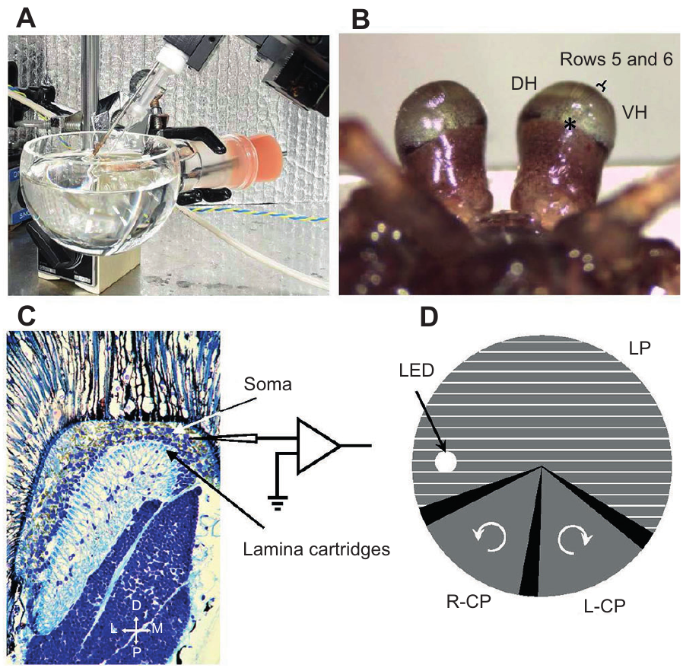
Sharp electrodes record retinal and lamina activity
Chiou and Wang recorded intracellular membrane potentials from the retina and lamina of Haptosquilla pulchella. A chilled animal was secured in oxygenated seawater, and a small eyestalk opening allowed a sharp electrode to approach the tissue near the midband.
Electrode resistances were 80–120 MΩ, and voltage was sampled at 10 kHz. A rotating polarizing assembly presented linear orientations followed by opposite circular states in a sequence lasting about 1.75 s. Reversing rotation provided a check on stimulus-order effects.
The preparation links specified polarization states to activity beyond the receptor layer. Cell categories were assigned partly from recording location and response profile, so physiological labels must not be treated as fully traced anatomical identities or identified transmitter classes.
Chiou & Wang (2020), Fig. 1(A–D). Original recording chamber, eyestalk access and lamina section.
Chiou & Wang (2020)
38
Notes:
• A sharp electrode can measure graded voltage changes inside a small cell. The eyestalk opening provides access without requiring the entire optical apparatus to be removed.
• The rotating assembly supplies a known sequence of states, while timing calibration identifies periods when opaque tape temporarily reduces the light. Reverse rotation changes the state order for the same recorded cell.
• Lamina-like response categories rely on more than morphology because the cells were not all filled and reconstructed. That limitation must remain explicit when connecting the recordings to later anatomical candidates.
References:
Chiou TH, Wang CW (2020). Neural processing of linearly and circularly polarized light signal in a mantis shrimp Haptosquilla pulchella (Miers, 1880). Journal of Experimental Biology 223: jeb219832. https://doi.org/10.1242/jeb.219832
Figure: Chiou & Wang (2020), Fig. 1(A–D). Original recording chamber, eyestalk access and lamina section.
Figure source: https://doi.org/10.1242/jeb.219832

Slide 39
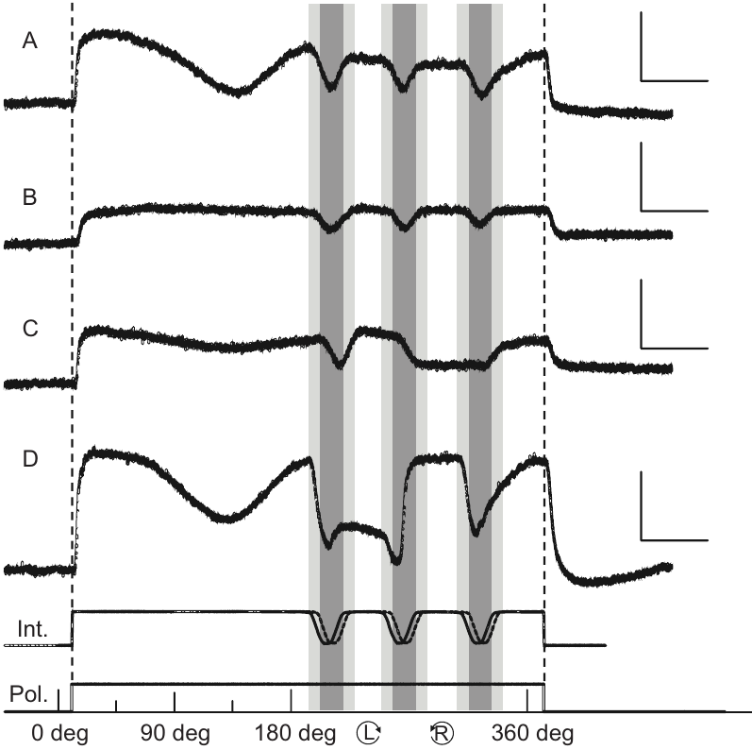
Receptors can combine linear and circular tuning
Elliptically polarized light includes both linear and circular components; purely linear and circular states are limiting cases. Chiou and Wang recorded Haptosquilla pulchella receptors during the same sequence of changing linear orientation and opposite circular handedness.
Some cells primarily tracked linear angle, others changed little with polarization, and another group preferred one circular handedness while retaining angle-dependent fluctuations during linear stimulation. The published traces carry 10-mV vertical and 250-ms horizontal scale bars.
Combined sensitivity supports receptors tuned to elliptical rather than perfectly circular states. It prevents transferring ideal circular selectivity from Odontodactylus directly to Haptosquilla. The inferred row assignments were based on function and access geometry, leaving the exact identified-cell correspondence less secure than a dye-filled recording.
Chiou & Wang (2020), Fig. 2(A–D). Original receptor traces for changing linear angle and circular handedness.
Chiou & Wang (2020), Fig. 1(A–D). Retinal access and the sampled lamina region.
Chiou & Wang (2020)
39
Notes:
• A receptor responsive to both components can favor a particular elliptical state. A difference between circular states does not require the response to all linear orientations to be identical.
• The same stimulus sequence tests these properties within one cell. Calibration traces identify temporary dimming at filter transitions, reducing confusion between polarization changes and interruptions of light.
• The three response classes describe physiology in this species. The proposed correspondence to hemispheres and particular midband rows remains an anatomical inference, rather than direct tracing of every recorded cell.
References:
Chiou TH, Wang CW (2020). Neural processing of linearly and circularly polarized light signal in a mantis shrimp Haptosquilla pulchella (Miers, 1880). Journal of Experimental Biology 223: jeb219832. https://doi.org/10.1242/jeb.219832
Figure: Chiou & Wang (2020), Fig. 2(A–D). Original receptor traces for changing linear angle and circular handedness.
Figure source: https://doi.org/10.1242/jeb.219832
Figure: Chiou & Wang (2020), Fig. 1(A–D). Retinal access and the sampled lamina region.
Figure source: https://doi.org/10.1242/jeb.219832

Slide 40
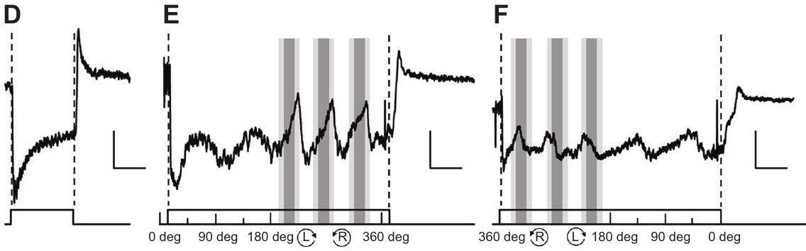
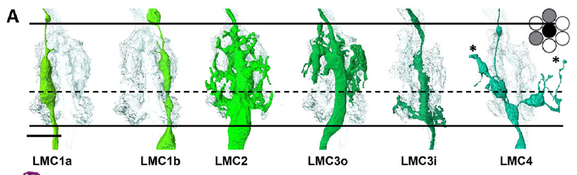
Lamina responses differ from single-receptor tuning
A lamina monopolar cell is an interneuron with a main axon traversing the lamina and branches within its processing layers. Chiou and Wang identified monopolar-cell-like responses in Haptosquilla pulchella from recording depth and characteristic graded voltage changes.
A 0.5-s white-light pulse produced hyperpolarization, a voltage shift toward a more negative membrane potential. Polarization-sensitive examples had two response episodes as the linear electric vector swept through 180°, including approximately 45° and 135° in one recording. Reverse rotation altered waveform shape while preserving its period.
The responses support convergence from differently oriented inputs. They do not establish every synaptic sign or prove that these physiological cells are a particular reconstructed monopolar subtype. Their voltage pattern differs from the single preferred-axis response of a photoreceptor.
Chiou & Wang (2020), Fig. 3(D–F). Monopolar-cell-like voltage responses to flashes and reversed polarization sequences.
Streets et al. (2025), Fig. 5(A). Published monopolar-cell and neighboring interneuron reconstructions.
Chiou & Wang (2020); Streets et al. (2025)
40
Notes:
• Hyperpolarization is the direction of the recorded voltage change, not a complete description of the underlying synaptic mechanism. A light-evoked negative shift can arise through several circuit operations.
• Two episodes during a half-turn differ from a simple single-axis receptor preference. Reversing the sequence also tests whether the response depends on dynamics as well as orientation.
• The recordings support transformed polarization information in the lamina. Naming a specific transmitter, postsynaptic receptor or ion channel would require molecular or pharmacological measurements that these experiments did not provide.
References:
Chiou TH, Wang CW (2020). Neural processing of linearly and circularly polarized light signal in a mantis shrimp Haptosquilla pulchella (Miers, 1880). Journal of Experimental Biology 223: jeb219832. https://doi.org/10.1242/jeb.219832
Streets A, England H, Marshall J (2025). Neural Repertoire Behind the World's Most Complex Retina: Neuroanatomy of the Stomatopod Lamina. Journal of Comparative Neurology 533: e70063. https://doi.org/10.1002/cne.70063
Figure: Chiou & Wang (2020), Fig. 3(D–F). Monopolar-cell-like voltage responses to flashes and reversed polarization sequences.
Figure source: https://doi.org/10.1242/jeb.219832
Figure: Streets et al. (2025), Fig. 5(A). Published monopolar-cell and neighboring interneuron reconstructions.
Figure source: https://doi.org/10.1002/cne.70063

Slide 41
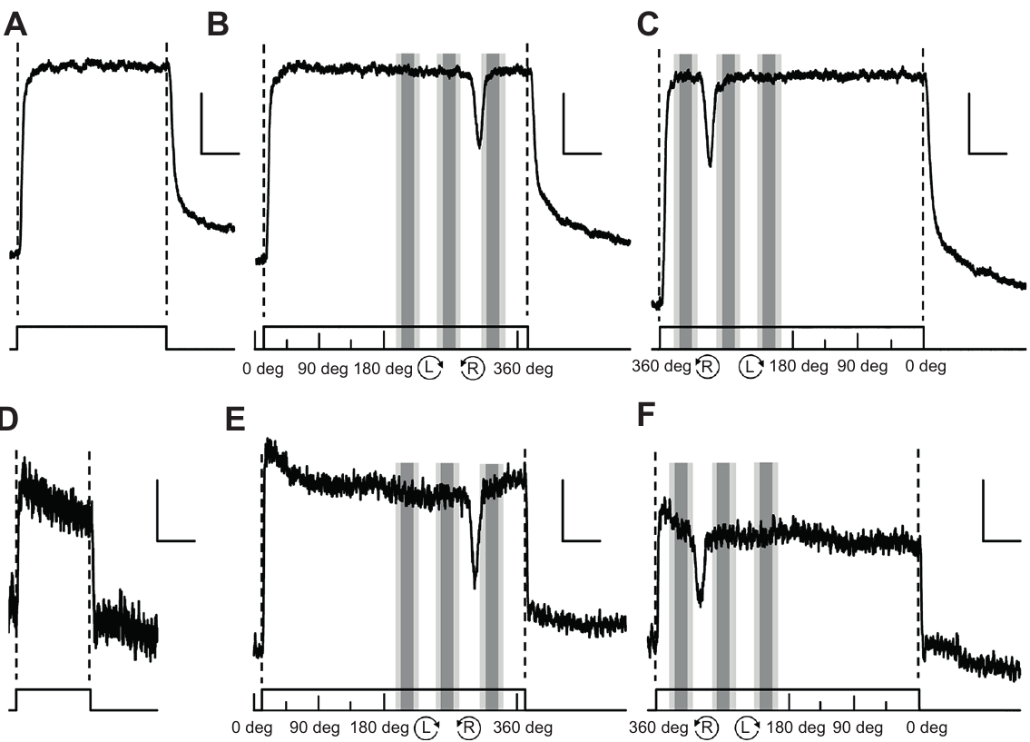
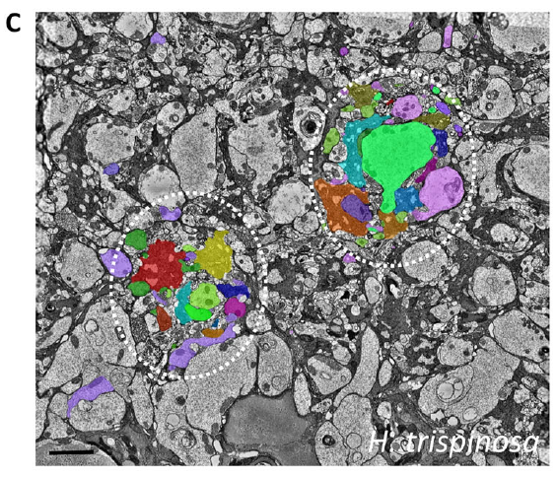
Lamina cells can favor circular handedness selectively
Chiou and Wang found lamina-region cells in Haptosquilla pulchella whose responses differed specifically during right-circularly polarized stimulation. A brief white-light pulse depolarized these cells, increasing their membrane potential relative to rest.
During the rotating stimulus sequence, right-circular light elicited a transient decrease from the depolarized level. Changing the stimulus to an off-axis position increased noise but preserved the qualitative response pattern. The brief intensity reductions at filter boundaries did not produce the same characteristic response.
Selectivity beyond the retina supports separation of linear and circular signal components in early visual processing. The cells were not fully morphologically identified, and the recording does not reveal a complete opponent circuit, its transmitter or its contribution to the learned feeding-tube choice.
Chiou & Wang (2020), Fig. 4(A–F). Original circular-sensitive responses under on-axis and off-axis stimulation.
Streets et al. (2025), Fig. 5(C). Published lamina micrographs with identified neuronal profiles.
Chiou & Wang (2020); Streets et al. (2025)
41
Notes:
• The response is defined relative to the cell's ongoing light-evoked depolarization. A transient decrease therefore differs from simply failing to respond to the entire stimulus.
• Off-axis stimulation checks whether the preference disappears with imperfect alignment. Comparing the response with known filter-transition dimming also addresses a possible intensity artifact.
• The result identifies a transformation of information after photoreception. A response resemblance to another animal's interneuron is a candidate identity, not evidence that the same named cell type or synaptic mechanism has been established here.
References:
Chiou TH, Wang CW (2020). Neural processing of linearly and circularly polarized light signal in a mantis shrimp Haptosquilla pulchella (Miers, 1880). Journal of Experimental Biology 223: jeb219832. https://doi.org/10.1242/jeb.219832
Streets A, England H, Marshall J (2025). Neural Repertoire Behind the World's Most Complex Retina: Neuroanatomy of the Stomatopod Lamina. Journal of Comparative Neurology 533: e70063. https://doi.org/10.1002/cne.70063
Figure: Chiou & Wang (2020), Fig. 4(A–F). Original circular-sensitive responses under on-axis and off-axis stimulation.
Figure source: https://doi.org/10.1242/jeb.219832
Figure: Streets et al. (2025), Fig. 5(C). Published lamina micrographs with identified neuronal profiles.
Figure source: https://doi.org/10.1002/cne.70063

Slide 42


Volume microscopy reconstructs lamina input columns
Serial block-face electron microscopy repeatedly images a tissue block as thin layers are removed, producing a three-dimensional volume. Streets and colleagues used it to follow photoreceptor axons and lamina interneurons in Haptosquilla trispinosa and Alachosquilla vicinia.
High-resolution stacks used 50-nm section steps, with image pixels approximately 10–15 nm across. Identified profiles were traced through successive images to reconstruct cartridge organization. Distal retinal cell identities constrained the assignment of the axons entering the lamina.
The volumes establish spatial relationships and branching patterns at finer resolution than conventional tissue staining. They were insufficient to identify all synapses in these preparations, so reconstructed proximity remains distinct from a directly measured connection, response sign or synaptic strength.
Streets et al. (2025), Fig. 3(A, B). Original electron micrographs with author-labeled receptor profiles.
Streets et al. (2025), Fig. 4(A–F). Author-reconstructed hemisphere photoreceptor terminals.
Streets et al. (2025)
42
Notes:
• The reconstruction follows the same process through successive sections rather than assigning connectivity from one two-dimensional image. Small section spacing improves continuity between neighboring profiles.
• The authors labeled the original segmented cells in color. The segmented profiles identify photoreceptor axons and terminal volumes across successive sections.
• A complete neuronal outline still need not include identifiable presynaptic and postsynaptic specializations. The available resolution supports anatomical reconstruction while leaving the detailed synaptic wiring incomplete.
References:
Streets A, England H, Marshall J (2025). Neural Repertoire Behind the World's Most Complex Retina: Neuroanatomy of the Stomatopod Lamina. Journal of Comparative Neurology 533: e70063. https://doi.org/10.1002/cne.70063
Figure: Streets et al. (2025), Fig. 3(A, B). Original electron micrographs with author-labeled receptor profiles.
Figure source: https://doi.org/10.1002/cne.70063
Figure: Streets et al. (2025), Fig. 4(A–F). Author-reconstructed hemisphere photoreceptor terminals.
Figure source: https://doi.org/10.1002/cne.70063

Slide 43

Monopolar branching preserves distinct candidate inputs
Streets and colleagues reconstructed multiple monopolar-cell types in individual lamina cartridges. LMC3 outer and inner cells concentrated branches in different external plexiform layers, while LMC2 extended branches through both layers. LMC1 cells occupied complementary sides of a cartridge.
These patterns occurred in two stomatopod species with different visual ecologies. Layer-restricted cells are candidates for retaining distinct spectral or polarization inputs, while cells spanning layers could integrate a broader set of receptor signals. The published reconstructions include 10-µm scale bars.
Opponency requires more than separated inputs: one stimulus must affect the output differently from another through a defined interaction. Morphology supports candidate circuitry but does not establish inhibitory synapses, the transmitter involved or the precise correspondence with physiologically classified cells.
Streets et al. (2025), Fig. 5(A–F). Comparative Alachosquilla interneuron reconstructions.
Streets et al. (2025)
43
Notes:
• A branch restricted to one layer is positioned near one receptor group, while a branch spanning both layers has access to a different mixture of signals. This distinction constrains possible computations.
• The comparative reconstruction tests whether the major branching patterns are unique to one sampled species. Similar arrangements occur despite differences in cartridge sizes and visual ecology.
• An opponent computation needs an interaction between channels, including the signs of their effects. Separate anatomical sampling cannot alone establish the sign or strength of that interaction.
References:
Streets A, England H, Marshall J (2025). Neural Repertoire Behind the World's Most Complex Retina: Neuroanatomy of the Stomatopod Lamina. Journal of Comparative Neurology 533: e70063. https://doi.org/10.1002/cne.70063
Figure: Streets et al. (2025), Fig. 5(A–F). Comparative Alachosquilla interneuron reconstructions.
Figure source: https://doi.org/10.1002/cne.70063

Slide 44


Cross-cartridge branches can integrate channels
Tangential cells have branches extending across processing columns. Streets and colleagues traced such cells and other interneurons beyond their parent lamina cartridges, finding routes between nearby midband rows as well as within rows and hemispheric regions.
To estimate possible contacts, the authors measured reconstructed volume overlap after approximately 50-nm dilation of segmented surfaces. Their matrices summarize proximity between identified processes. Midband branches often extended within the same visual column, potentially linking different spectral sampling rows.
These are candidate integration routes. Geometric overlap is a necessary spatial opportunity for many synapses but is not proof of a synapse, its direction or its strength. The heat-map values therefore must not be relabeled as measured synaptic weights or confirmed physiological connectivity.
Streets et al. (2025), Fig. 6(C, D). The authors’ maps of branches extending into neighboring cartridges.
Streets et al. (2025), Fig. 6(A, B). Original proximity-derived overlap matrices, not verified synaptic connections.
Streets et al. (2025)
44
Notes:
• A cartridge receives an ommatidial input, but branches need not remain within that single column. Cross-cartridge anatomy permits a cell to encounter signals originating from neighboring receptor populations.
• Dilating the segmented surfaces increases the chance of detecting neighboring membranes in the reconstructed volume. The resulting overlap is a proxy for possible contact rather than a synaptic count.
• The matrices are the authors' original published calculations. Their colors encode geometric overlap, and interpreting them as excitatory or inhibitory connection strength would exceed the measurement.
References:
Streets A, England H, Marshall J (2025). Neural Repertoire Behind the World's Most Complex Retina: Neuroanatomy of the Stomatopod Lamina. Journal of Comparative Neurology 533: e70063. https://doi.org/10.1002/cne.70063
Figure: Streets et al. (2025), Fig. 6(C, D). The authors’ maps of branches extending into neighboring cartridges.
Figure source: https://doi.org/10.1002/cne.70063
Figure: Streets et al. (2025), Fig. 6(A, B). Original proximity-derived overlap matrices, not verified synaptic connections.
Figure source: https://doi.org/10.1002/cne.70063

Slide 45

The complete opponent circuit remains unresolved
Wang and Marshall varied illumination intensity as well as spectral composition in Haptosquilla trispinosa. Double-layered blue tents reduced blue-target discrimination, whereas neutral-density dimming preserved useful blue and green choices. Green choices exceeded 80% under the dimmest tested neutral illumination.
Together with restricted-spectrum discrimination, these controls support spectral comparison beyond a simple brightness rule. Streets and colleagues provide anatomical candidate pathways, while Chiou and Wang recorded transformed polarization responses in a different Haptosquilla species. The studies test complementary but distinct levels of processing.
A hybrid account of spectral recognition and opponency remains supported as a proposal, not a completed circuit. The comparing neurons, transmitter identities, postsynaptic receptors, ion channels and causal links to particular color decisions have not been established by these experiments.
Wang & Marshall (2025), Fig. 8(A, B). Color-versus-grey choices under dim colored and neutral illumination.
Streets et al. (2025), Fig. 5(C). Original lamina tissue profiles that constrain candidate pathways.
Wang & Marshall (2025); Streets et al. (2025); Chiou & Wang (2020)
45
Notes:
• Dimming and narrowing a spectrum change different properties of the stimulus. Neutral illumination controls help separate a loss of spectral contrast from a general inability to choose under weaker light.
• The behavioral controls support channel comparison, the reconstructions constrain available pathways, and the polarization recordings establish that lamina responses can differ from receptor responses. None of those measurements supplies every missing step in the same species and task.
• A complete mechanism would connect identified inputs through known synapses to recorded activity and behavior. The evidence supports several parts of that chain while leaving molecular identity and the causal color-decision circuit unresolved.
References:
Wang CWJ, Marshall NJ (2025). Behavioural evidence of spectral opponent processing in the visual system of stomatopod crustaceans. Journal of Experimental Biology 228: jeb247952. https://doi.org/10.1242/jeb.247952
Streets A, England H, Marshall J (2025). Neural Repertoire Behind the World's Most Complex Retina: Neuroanatomy of the Stomatopod Lamina. Journal of Comparative Neurology 533: e70063. https://doi.org/10.1002/cne.70063
Chiou TH, Wang CW (2020). Neural processing of linearly and circularly polarized light signal in a mantis shrimp Haptosquilla pulchella (Miers, 1880). Journal of Experimental Biology 223: jeb219832. https://doi.org/10.1242/jeb.219832
Figure: Wang & Marshall (2025), Fig. 8(A, B). Color-versus-grey choices under dim colored and neutral illumination.
Figure source: https://doi.org/10.1242/jeb.247952
Figure: Streets et al. (2025), Fig. 5(C). Original lamina tissue profiles that constrain candidate pathways.
Figure source: https://doi.org/10.1002/cne.70063

Slide 46
Key takeaways
Many inputs, coarse discrimination Narrow spectral receptors do not guarantee fine color resolution; Haptosquilla wavelength thresholds were approximately 12–25 nm in the tested choice assay.
Pigments plus filters Tiered receptors and serial filters shape effective spectral sensitivity; two UV pigments can support several receptor classes through cone filtering.
Polarization-sensitive microvilli Aligned membranes produce directional absorption, and distinct hemispheric receptor axes provide complementary linear-polarization inputs.
R8 optical conversion Quarter-wave retardance transforms opposite circular states into orthogonal linear inputs for the underlying receptors in species with the required geometry.
Active polarization sampling Torsional eye movements change receptor alignment; object–background polarization contrast can favor an orientation different from object alignment alone.
Processing and its limits Behavior supports spectral comparison and lamina recordings support polarization transformations; hybrid color decoding and the complete synaptic mechanism remain unresolved.
Thoen et al. (2014); Bok et al. (2014, 2018); Chiou et al. (2008); Roberts et al. (2009); Daly et al. (2016); Wang & Marshall (2025); Streets et al. (2025)
46
Notes:
• Behavioral thresholds and receptor tuning are different measurements. The wavelength-choice assay found coarse discrimination despite several narrow receptor channels, while later grey-target tests supported spectral comparison under restricted illumination.
• Light encounters receptor tiers and filters in sequence. Measuring pigment absorption alone cannot specify intact receptor sensitivity, and the ultraviolet cone-filter system can produce several effective channels from two functional pigments.
• Linear-polarization sensitivity follows microvillar orientation. Multiple offset axes provide different inputs, but a central comparison and its synaptic signs require evidence beyond the receptor geometry.
• R8 retardance can convert opposite circular handedness into different linear states before the main rhabdom absorbs the light. Species differ in optical performance, so ideal circular selectivity cannot be assigned to every mantis shrimp.
• Torsion changes sampling axes around the viewing direction. The eye-movement studies support enhanced modeled hemispheric contrast, including circumstances where the best orientation depends on the background as well as the object.
• Lamina recordings and reconstructions constrain early processing, while behavioral tasks establish usable visual distinctions. They leave the complete spectral decoder, molecular synaptic identities and direct causal route to color choices unresolved.
References:
Cronin TW, Marshall NJ (1989). A retina with at least ten spectral types of photoreceptors in a mantis shrimp. Nature 339: 137-140. https://doi.org/10.1038/339137a0
Thoen HH, How MJ, Chiou TH, Marshall J (2014). A Different Form of Color Vision in Mantis Shrimp. Science 343: 411-413. https://doi.org/10.1126/science.1245824
Bok MJ, Porter ML, Place AR, Cronin TW (2014). Biological Sunscreens Tune Polychromatic Ultraviolet Vision in Mantis Shrimp. Current Biology 24: 1636-1642. https://doi.org/10.1016/j.cub.2014.05.071
Chiou TH, Kleinlogel S, Cronin T, Caldwell R, Loeffler B, Siddiqi A, Goldizen A, Marshall J (2008). Circular Polarization Vision in a Stomatopod Crustacean. Current Biology 18: 429-434. https://doi.org/10.1016/j.cub.2008.02.066
Roberts NW, Chiou TH, Marshall NJ, Cronin TW (2009). A biological quarter-wave retarder with excellent achromaticity in the visible wavelength region. Nature Photonics 3: 641-644. https://doi.org/10.1038/nphoton.2009.189
Kleinlogel S, White AG (2008). The Secret World of Shrimps: Polarisation Vision at Its Best. PLoS ONE 3: e2190. https://doi.org/10.1371/journal.pone.0002190
Daly IM, How MJ, Partridge JC, Temple SE, Marshall NJ, Cronin TW, Roberts NW (2016). Dynamic polarization vision in mantis shrimps. Nature Communications 7: 12140. https://doi.org/10.1038/ncomms12140
Bok MJ, Roberts NW, Cronin TW (2018). Behavioural evidence for polychromatic ultraviolet sensitivity in mantis shrimp. Proceedings of the Royal Society B: Biological Sciences 285: 20181384. https://doi.org/10.1098/rspb.2018.1384
Chiou TH, Wang CW (2020). Neural processing of linearly and circularly polarized light signal in a mantis shrimp Haptosquilla pulchella (Miers, 1880). Journal of Experimental Biology 223: jeb219832. https://doi.org/10.1242/jeb.219832
Wang CWJ, Marshall NJ (2025). Behavioural evidence of spectral opponent processing in the visual system of stomatopod crustaceans. Journal of Experimental Biology 228: jeb247952. https://doi.org/10.1242/jeb.247952
Streets A, England H, Marshall J (2025). Neural Repertoire Behind the World's Most Complex Retina: Neuroanatomy of the Stomatopod Lamina. Journal of Comparative Neurology 533: e70063. https://doi.org/10.1002/cne.70063

