Slide 1
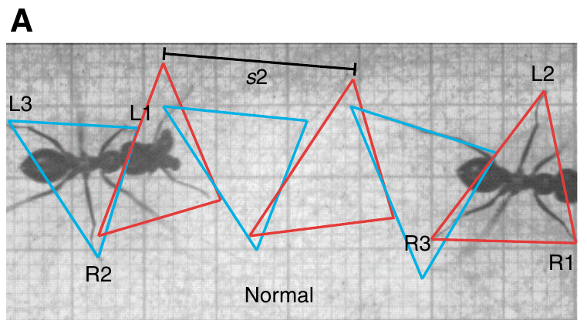
NEUR 411 · NEUROETHOLOGY · FALL 2026
Lecture 28
Navigation I:
desert ant path integration (Wehner)
Friday, October 30, 2026
Jordan Lopez, Ph.D.
Professor of Neurobiology & Biomedical Engineering
Wittlinger et al. (2007), Fig. 3(A). Normal tripod gait in a walking Cataglyphis fortis.
Notes:
Navigation I: desert ant path integration (Wehner)
Lecture 28. NEUR 411 · NEUROETHOLOGY · FALL 2026. Friday, October 30, 2026.
Figure: Wittlinger et al. (2007), Fig. 3(A). Normal tripod gait in a walking Cataglyphis fortis.
Figure source: https://doi.org/10.1242/jeb.02657

Slide 2
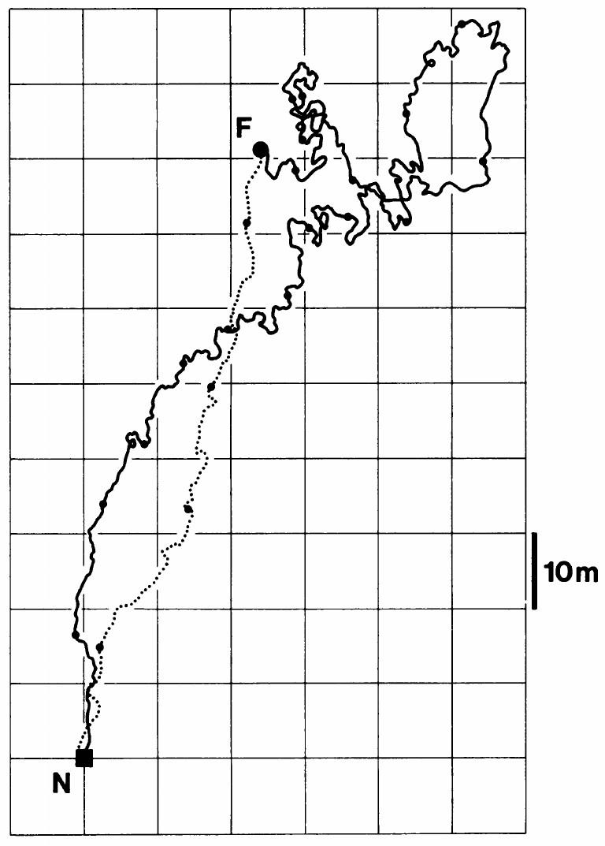
A home vector survives a winding outward journey
Path integration is the continual updating of direction and distance from a starting point using information gathered during movement. A home vector gives the direction and distance back to the nest, so it condenses the whole outward trip into one quantity. Because the update runs continuously, the animal always holds an estimate of where its nest lies.
Müller and Wehner recorded a natural foraging trip of Cataglyphis fortis in Tunisia. The outward path measured 354.5 m, while the farthest point of the trip lay 113.2 m from the nest. After finding food, the ant returned along a comparatively direct inbound route. The homeward path was therefore far shorter than the path the ant had walked outward.
The gap between outward path length and nest displacement marks vector-guided homing rather than route retracing. A direct return after a winding outward route shows that the vector summed every segment of the trip into one direction and distance. A retracing ant would instead need a stored memory of every turn. The vector summary avoids that memory requirement.
Müller & Wehner (1988), Fig. 1. A natural outbound route and direct homeward return.
Müller & Wehner (1988)
02
Notes:
• **Path integration** is the continual updating of direction and distance from a starting point using information gathered during movement. A **home vector** specifies the direction and distance back to the nest; it need not reproduce the sequence of outward turns.
• Müller and Wehner recorded a natural foraging trip of Cataglyphis fortis in Tunisia. The outward path measured 354.5 m, while the maximum distance from the nest was 113.2 m. After finding food, the ant returned along a comparatively direct inbound route.
• The difference between outward path length and nest displacement separates route retracing from vector-guided homing. This recorded journey documents the behavior, but does not identify a neuron that stores the vector or establish the mathematical precision of its updating mechanism.
References:
Müller M, Wehner R (1988). Path integration in desert ants, Cataglyphis fortis. Proceedings of the National Academy of Sciences 85(14):5287–5290. https://doi.org/10.1073/pnas.85.14.5287
Figure: Müller & Wehner (1988), Fig. 1. A natural outbound route and direct homeward return.
Figure source: https://doi.org/10.1073/pnas.85.14.5287

Slide 3
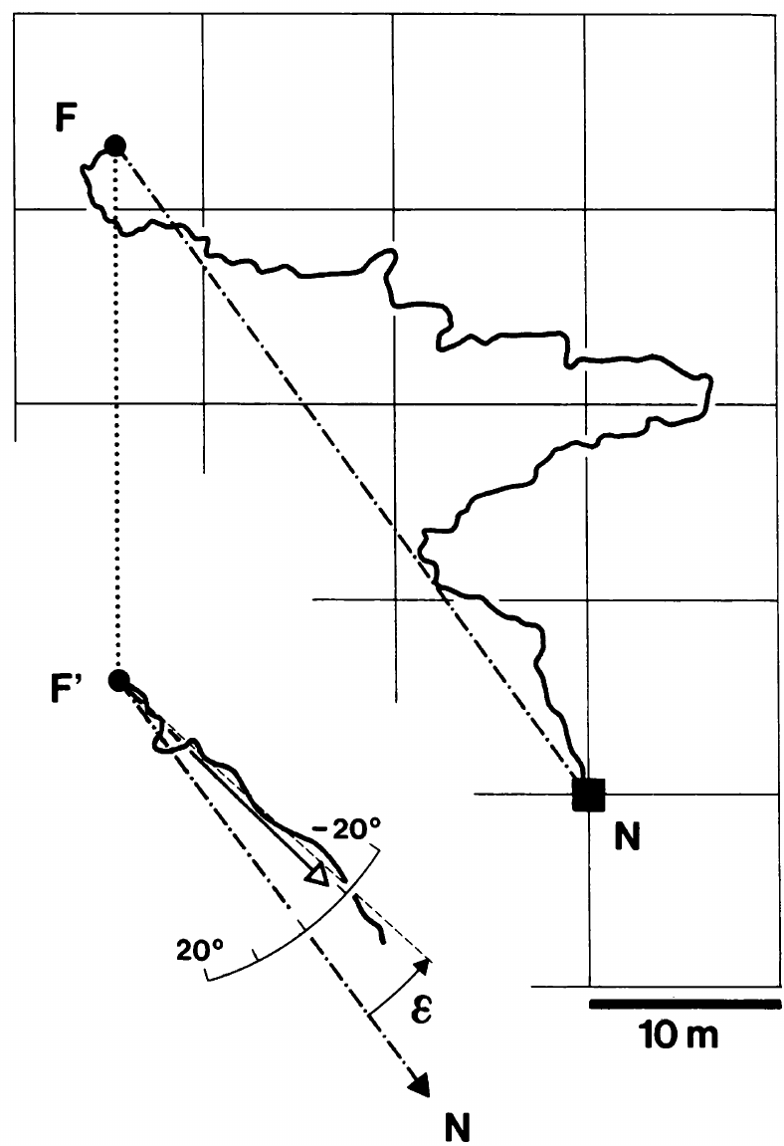
Displacement separates the vector from the real nest
Passive displacement changes an ant's position without the walking movements that normally update its home vector. The vector is a record of the ant's own movement, so a transfer that bypasses that movement leaves the record pointing elsewhere. A displaced ant therefore expresses a direction suited to its earlier position rather than to the nest.
Müller and Wehner tracked the course taken by individual ants after they were moved. The question was whether each ant still expressed information from its own outward movement. The nest was no longer where the earlier movements had placed it. A course that matches the outward movement would therefore reveal the origin of the heading.
The released ant's heading retained information from its outward journey despite the transfer. That result points to movement-derived navigation rather than immediate attraction to the true nest. The ant's heading depended on where it had been walking, not on where the nest lay. This dependence is what the displacement test was designed to reveal.
Müller & Wehner (1988), Fig. 4. Natural-path displacement and the resulting homeward course.
Müller & Wehner (1988)
03
Notes:
• Passive displacement changes an ant’s geographical position without supplying the walking movements that normally update its home vector. A displaced ant can therefore express a direction appropriate to its earlier position rather than to the nest’s actual location.
• Müller and Wehner captured a food-carrying ant at its feeding location and released it elsewhere in open terrain. The animal’s subsequent course was compared with the geographical nest direction and the course predicted from its recorded outbound trajectory, using a 10 m spatial scale.
• The course retained information from the outward journey despite the transfer. The test distinguishes movement-derived navigation from immediate attraction to the true nest, while leaving landmark guidance and systematic searching available as additional mechanisms under natural conditions.
References:
Müller M, Wehner R (1988). Path integration in desert ants, Cataglyphis fortis. Proceedings of the National Academy of Sciences 85(14):5287–5290. https://doi.org/10.1073/pnas.85.14.5287
Figure: Müller & Wehner (1988), Fig. 4. Natural-path displacement and the resulting homeward course.
Figure source: https://doi.org/10.1073/pnas.85.14.5287

Slide 4
Displaced foragers reveal a stored outward vector
Müller and Wehner captured food-carrying ants at the feeding location and released each one in open terrain. Each ant's later course was followed on a 10 m spatial scale. That course was measured against the true geographical direction of the nest and against the course predicted from the ant's recorded outbound trajectory. Its outward walk had been recorded before the ant was captured.
In the two-leg experiments, both legs varied over lengths of 5–10 m and turning angles spanning 0–180°. The plotted experiment used a first leg of 10 m and a second leg of 5 m. Release occurred within one minute of capture, which shortened the time before the directional test. The experiments produced a homing direction for each combination of lengths and angles.
Under natural conditions, landmark guidance and systematic searching remain available as additional mechanisms for locating the nest. Each of these can operate alongside a stored home vector, and neither one replaces the other. Landmark guidance and systematic searching are listed as separate mechanisms, each one an addition to the path integrator.
Müller & Wehner (1988), Fig. 4. Natural-path displacement and the resulting homeward course.
Müller & Wehner (1988)
03a
Notes:
• Displaced foragers reveal a stored outward vector.
• Explanation 1.
– Müller and Wehner captured food-carrying ants at the feeding location and released each one in open terrain
– Each ant's later course was followed on a 10 m spatial scale. That course was measured against the true geographical direction of the nest and against the course predicted from the ant's recorded outbound trajectory. Its outward walk had been recorded before the ant was captured.
• Explanation 2.
– In the two-leg experiments, both legs varied over lengths of 5–10 m and turning angles spanning 0–180°
– The plotted experiment used a first leg of 10 m and a second leg of 5 m. Release occurred within one minute of capture, which shortened the time before the directional test. The experiments produced a homing direction for each combination of lengths and angles.
• Explanation 3.
– Under natural conditions, landmark guidance and systematic searching remain available as additional mechanisms for locating the nest
– Each of these can operate alongside a stored home vector, and neither one replaces the other. Landmark guidance and systematic searching are listed as separate mechanisms, each one an addition to the path integrator.
• Source.
– The figure and the measurements come from Müller & Wehner (1988).
– Each statement is tied to the recordings or observations of that study.
References:
Müller M, Wehner R (1988). Path integration in desert ants, Cataglyphis fortis. Proceedings of the National Academy of Sciences 85(14):5287–5290. https://doi.org/10.1073/pnas.85.14.5287

Slide 5
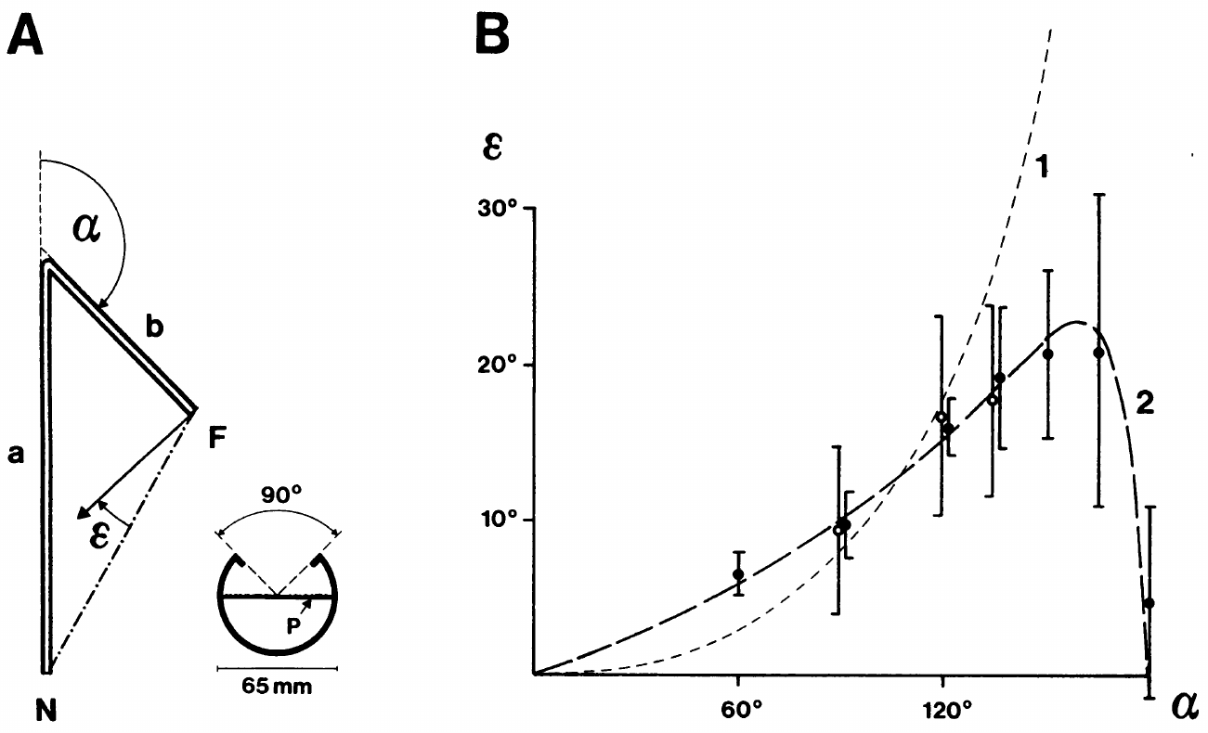
Angular channels constrain the path being integrated
An experimental path can specify the directions and distances an ant experiences before homing. Müller and Wehner trained Cataglyphis fortis through narrow plastic channels, then moved individuals to an open test field where the channels were absent. Each training path therefore defined a known sequence of directions for the ant to integrate.
The experiment varied the two legs over a range of lengths and turning angles, so many route geometries could be tested with one procedure. Release occurred soon after capture, which kept the delay between training and the directional test short. Each animal was therefore tested while its training remained recent.
The initial homeward course reflects the ant's accumulated directional estimate rather than its ability to follow the training channel backward. Because the channels were removed during testing, the course depends on the geometry integrated during training. The expressed direction therefore measures what the ant computed, not what it retraced. This measure therefore isolates the integrated estimate.
Müller & Wehner (1988), Fig. 2(A–B). Two-leg training and measured homing-direction errors.
Müller & Wehner (1988)
04
Notes:
• An experimental path can specify the directions and distances an ant experiences before homing. Müller and Wehner trained Cataglyphis fortis through narrow plastic channels, then transferred individuals from the feeder to a separate open test field.
• The two legs were varied over lengths of 5–10 m and turning angles spanning 0–180°. In the plotted experiment, the first leg was 10 m and the second 5 m. Release occurred within one minute of capture, reducing the delay between training and the directional test.
• The recorded initial homeward course measures the ant’s accumulated directional estimate rather than its ability to follow the training channel backward. Removing the channels during testing separates the geometry experienced during acquisition from the geometry available during expression.
References:
Müller M, Wehner R (1988). Path integration in desert ants, Cataglyphis fortis. Proceedings of the National Academy of Sciences 85(14):5287–5290. https://doi.org/10.1073/pnas.85.14.5287
Figure: Müller & Wehner (1988), Fig. 2(A–B). Two-leg training and measured homing-direction errors.
Figure source: https://doi.org/10.1073/pnas.85.14.5287

Slide 6
Homing errors depend on the outward turning angle
Systematic error is a directional deviation that varies predictably with an experimental manipulation, in contrast with random scatter among journeys. Müller and Wehner measured the angular difference between the true homeward direction and the course expressed after two-leg training. The sign of each deviation shows which way the expressed course lay.
With outbound legs of 10 m and 5 m, the error grew as the turning angle approached about 150°, reaching roughly 20° in the published measurements. The error fell back toward zero in the straight and reversed arrangements. The largest bias therefore appeared at intermediate angles rather than at the extremes.
The angle-dependent pattern supports an approximate updating rule for the Cataglyphis trajectories tested. The rule is written as a mathematical account, so it can be checked against route geometries that the original experiments did not use. The rule makes quantitative predictions for these geometries. It can therefore be tested on new route geometries.
Müller & Wehner (1988), Fig. 2(A–B). Two-leg training and measured homing-direction errors.
Müller & Wehner (1988)
05
Notes:
• **Systematic error** means a directional deviation that varies predictably with an experimental manipulation. It differs from random scatter among journeys. Müller and Wehner measured the angular difference between the true homeward direction and the course expressed after two-leg training.
• With outbound legs of 10 m and 5 m, the error increased as the turning angle approached approximately 150°, reaching about 20° in the published measurements. The error returned toward zero at the limiting straight or reversed arrangements.
• The angle-dependent pattern supported an approximate updating rule under these conditions. It does not prove that every ant species, every route geometry, or every neural representation uses the same approximation; the inference concerns the measured Cataglyphis trajectories and their proposed mathematical account.
References:
Müller M, Wehner R (1988). Path integration in desert ants, Cataglyphis fortis. Proceedings of the National Academy of Sciences 85(14):5287–5290. https://doi.org/10.1073/pnas.85.14.5287
Figure: Müller & Wehner (1988), Fig. 2(A–B). Two-leg training and measured homing-direction errors.
Figure source: https://doi.org/10.1073/pnas.85.14.5287

Slide 7
Sun and polarization cues support the directional test
A celestial compass derives heading information from features of the sky. Direct sunlight and the pattern of polarized skylight provide related but separable information. Polarization refers to the orientation of the electric field oscillation in a light wave. Ants can therefore draw heading information from either source. Both sources therefore contribute heading information.
Müller and Wehner measured homing errors while the ants used the sun, polarized skylight, or both. Each compass condition was tested with the same navigation procedure. The compass input was the only variable that changed between conditions. The homing error therefore reflects the compass information available to the ant. The sun and polarized skylight were tested separately and together.
Because the error pattern persisted across compass conditions, the bias lies in the path-integration computation rather than in one defective sky cue. A single sky cue would have produced a pattern tied to that cue alone. The persistence therefore points to the computation itself. The bias therefore has a computational origin.
Müller & Wehner (1988), Fig. 2(A–B). Two-leg training and measured homing-direction errors.
Müller & Wehner (1988)
06
Notes:
• A **celestial compass** derives heading information from features of the sky. Direct sunlight and the pattern of polarized skylight provide related but separable information. Polarization refers to the orientation of the electric field oscillation in a light wave.
• Müller and Wehner compared homing errors while ants used the sun, polarized skylight, or both. Screening the sun removed direct solar information; painting the dorsal rim of the compound eyes removed access to the specialized polarization-sensitive eye region. The 10 m and 5 m route still produced systematic errors.
• The persistence of the error pattern across compass conditions argues against a single defective sky cue accounting for the path-integration bias. Restricted sky windows can themselves distort polarization estimates, so the authors considered this separate source of compass error in their interpretation.
References:
Müller M, Wehner R (1988). Path integration in desert ants, Cataglyphis fortis. Proceedings of the National Academy of Sciences 85(14):5287–5290. https://doi.org/10.1073/pnas.85.14.5287
Figure: Müller & Wehner (1988), Fig. 2(A–B). Two-leg training and measured homing-direction errors.
Figure source: https://doi.org/10.1073/pnas.85.14.5287

Slide 8
Screening and painting remove two compass inputs
Screening the sun removed direct solar information from the compass. Ants on this route still erred under the screening. The same two-leg geometry had produced homing errors of about 20° at turning angles near 150° in the earlier test. Screening removed the direct sun's information but left the polarized pattern in place. The polarized skylight pattern was still available to the screened ants.
Painting the dorsal rim of the compound eyes removed access to the specialized polarization-sensitive eye region. Ants with painted eyes also erred on the 10 m and 5 m route, which uses the same two-leg geometry as the screened test. Direct sunlight stayed available to these ants, so the sun cue was not removed.
Restricted sky windows can themselves distort polarization estimates. The authors treated this as a separate source of compass error when they interpreted their homing results, which kept the two sources apart. A narrow channel limits the visible part of the sky, which is one way a sky window becomes restricted.
Müller & Wehner (1988), Fig. 2(A–B). Two-leg training and measured homing-direction errors.
Müller & Wehner (1988)
06a
Notes:
• Screening and painting remove two compass inputs.
• Explanation 1.
– Screening the sun removed direct solar information from the compass
– Ants on this route still erred under the screening. The same two-leg geometry had produced homing errors of about 20° at turning angles near 150° in the earlier test. Screening removed the direct sun's information but left the polarized pattern in place. The polarized skylight pattern was still available to the screened ants.
• Explanation 2.
– Painting the dorsal rim of the compound eyes removed access to the specialized polarization-sensitive eye region
– Ants with painted eyes also erred on the 10 m and 5 m route, which uses the same two-leg geometry as the screened test. Direct sunlight stayed available to these ants, so the sun cue was not removed.
• Explanation 3.
– Restricted sky windows can themselves distort polarization estimates
– The authors treated this as a separate source of compass error when they interpreted their homing results, which kept the two sources apart. A narrow channel limits the visible part of the sky, which is one way a sky window becomes restricted.
• Source.
– The figure and the measurements come from Müller & Wehner (1988).
– Each statement is tied to the recordings or observations of that study.
References:
Müller M, Wehner R (1988). Path integration in desert ants, Cataglyphis fortis. Proceedings of the National Academy of Sciences 85(14):5287–5290. https://doi.org/10.1073/pnas.85.14.5287

Slide 9
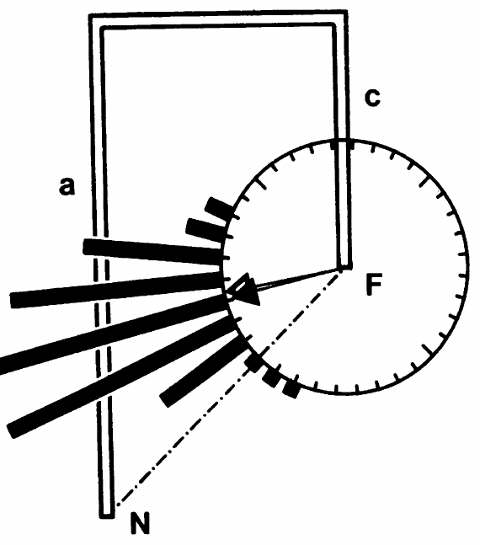
Three-leg routes test an approximate updating rule
An explanation fitted to one route geometry has to predict a different sequence of movements. Müller and Wehner added a third leg to the channel arrangement, introducing a second 90° turn in place of repeating the original two-leg design. The new route tested whether the rule still held for an unfamiliar sequence of turns.
Released ants deviated by 30.8° from the true home direction, and the approximation derived from the earlier experiments predicted a deviation of 33.7°. This close agreement shows that the rule generalizes beyond the angles used to derive it. The rule predicted that value before the three-leg test. This match is an independent test of the approximation.
The experiment measured the animal's course rather than the voltage, transmitter or synaptic activity of an identified integrator. The behavioral match therefore describes the output of the computation rather than its cellular mechanism. The result constrains the computation rather than identifying its cells. Cellular recordings would be needed to test that mechanism.
Müller & Wehner (1988), Fig. 3. Three-leg training and homing directions.
Müller & Wehner (1988)
07
Notes:
• An explanation fitted to one route geometry must also account for a different sequence of movements. Müller and Wehner added a third leg to the channel arrangement, introducing a second 90° turn rather than repeating the original two-leg experiment.
• The first leg was 10 m and the second and third legs were each 5 m. Ants subsequently released into open terrain deviated by 30.8° from the true home direction. The approximation derived from the earlier experiments predicted a deviation of 33.7°.
• The agreement extended the behavioral account beyond the particular angles used to derive it. A successful prediction of homing direction still leaves the cellular implementation unresolved: the experiment measured the animal’s course, not the voltage, transmitter or synaptic activity of an identified integrator.
References:
Müller M, Wehner R (1988). Path integration in desert ants, Cataglyphis fortis. Proceedings of the National Academy of Sciences 85(14):5287–5290. https://doi.org/10.1073/pnas.85.14.5287
Figure: Müller & Wehner (1988), Fig. 3. Three-leg training and homing directions.
Figure source: https://doi.org/10.1073/pnas.85.14.5287

Slide 10
Natural routes can limit the cost of directional bias
Route geometry determines how an approximate path integrator accumulates error. A sharp sustained turn can produce a large deviation, whereas turns in opposite directions can partly cancel their effects on the estimated homeward direction. Opposing turns keep the accumulated error small along many natural routes. Repeated sharp reversals produce the largest errors.
Müller and Wehner tested the proposed updating rule against recorded natural foraging paths. In the displaced example, the expressed course departed from the real nest direction by about 20°, matching the direction predicted from that ant's outward trajectory. The approximation was tested on paths that the ants had really walked.
The authors observed that natural Cataglyphis paths seldom contain the repeated sharp backward turns that generate the largest experimental errors. Under this ecological interpretation, the home vector serves typical routes well. Repeated sharp reversals produce the largest errors, so natural routes rarely expose the rule's weakest case. The authors' argument rests on the route statistics of natural foraging.
Müller & Wehner (1988), Fig. 4. Natural-path displacement and the resulting homeward course.
Müller & Wehner (1988)
08
Notes:
• Route geometry determines how an approximate path integrator accumulates error. A sharp sustained turn can produce a large deviation, whereas turns in opposite directions may partly cancel their effects on the estimated homeward direction.
• Müller and Wehner compared the proposed updating rule with recorded natural foraging paths. In the displaced example, the expressed course departed from the real nest direction by approximately 20°, consistent with the direction predicted from that ant’s outward trajectory.
• The authors noted that natural Cataglyphis paths rarely contained the repeated sharp backward turns that generated especially large experimental errors. This ecological interpretation explains possible usefulness without establishing perfect accuracy; landmarks and searching remain relevant when a home vector is insufficient.
References:
Müller M, Wehner R (1988). Path integration in desert ants, Cataglyphis fortis. Proceedings of the National Academy of Sciences 85(14):5287–5290. https://doi.org/10.1073/pnas.85.14.5287
Figure: Müller & Wehner (1988), Fig. 4. Natural-path displacement and the resulting homeward course.
Figure source: https://doi.org/10.1073/pnas.85.14.5287

Slide 11
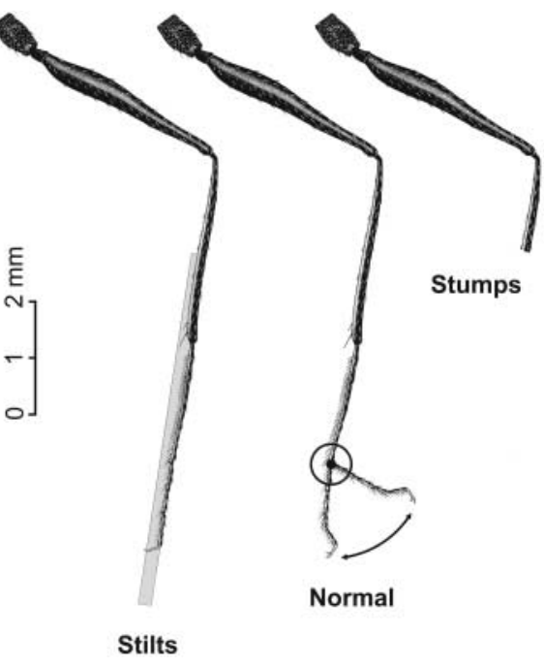
Leg length manipulation changes the estimated distance
An odometer is a mechanism for estimating distance traveled. A stride is one complete movement cycle of a particular leg. Altering leg length changes the distance covered in each stride, while the distance already experienced before the change stays the same. Stride length, not the number of steps, sets how far each cycle carries the ant.
Wittlinger and colleagues tested whether a distance estimate built with legs of one length still works after the legs change. Because the stored distance was acquired before the manipulation, any resulting error reflects the altered locomotion itself. The design makes locomotion the only variable that changes between the outbound and inbound walks.
The resulting distance error therefore probes locomotor information. Leg manipulation changes sensory feedback and movement commands together, so the error points to the combined signal rather than to one input. The error therefore reflects locomotion, not the training history. Changing the legs after training is the design's key feature. The error is measured directly in each animal.
Wittlinger et al. (2006), Fig. 2. Normal legs, stilts and stumps.
Wittlinger et al. (2006)
09
Notes:
• An **odometer** is a mechanism for estimating distance traveled. A **stride** is one complete movement cycle of a particular leg. Altering leg length can change the distance covered during each stride without changing the distance experienced before the manipulation.
• Wittlinger and colleagues trained Cataglyphis fortis to a feeder 10 m from the nest. At the feeder, they lengthened legs with attached pig bristles, producing stilts, or shortened legs, producing stumps. Food-carrying ants were then tested in a separate channel.
• The manipulation was performed after the outbound distance had been acquired, allowing an unequal relationship between outbound and inbound strides. The resulting distance error tests locomotor information, but leg surgery alone does not distinguish peripheral sensory feedback from centrally generated movement signals.
References:
Wittlinger M, Wehner R, Wolf H (2006). The Ant Odometer: Stepping on Stilts and Stumps. Science 312(5782):1965–1967. https://doi.org/10.1126/science.1126912
Figure: Wittlinger et al. (2006), Fig. 2. Normal legs, stilts and stumps.
Figure source: https://doi.org/10.1126/science.1126912

Slide 12
Stilts and stumps alter the distance per stride
Wittlinger and colleagues trained Cataglyphis fortis to a feeder 10 m from the nest. At the feeder, attached pig bristles lengthened the legs to produce stilts, and shortened legs produced stumps. Food-carrying ants were then tested in a separate channel, after their outward distance had already been learned on normal legs.
The first study of this manipulation appeared in Science in 2006 under the title The Ant Odometer: Stepping on Stilts and Stumps. The later follow-up, published in 2007, added a second level of leg shortening. The 2006 paper's figures show normal legs, stilts and stumps side by side.
The 2007 follow-up tested stumps that differed in which leg region was removed. Its normal-legged group served as the reference for each lengthened and shortened condition. Its figures present the four leg conditions as color-coded search distributions.
Wittlinger et al. (2006), Fig. 2. Normal legs, stilts and stumps.
Wittlinger et al. (2006)
09a
Notes:
• Stilts and stumps alter the distance per stride.
• Explanation 1.
– Wittlinger and colleagues trained Cataglyphis fortis to a feeder 10 m from the nest
– At the feeder, attached pig bristles lengthened the legs to produce stilts, and shortened legs produced stumps. Food-carrying ants were then tested in a separate channel, after their outward distance had already been learned on normal legs.
• Explanation 2.
– The first study of this manipulation appeared in Science in 2006 under the title The Ant Odometer: Stepping on Stilts and Stumps
– The later follow-up, published in 2007, added a second level of leg shortening. The 2006 paper's figures show normal legs, stilts and stumps side by side.
• Explanation 3.
– The 2007 follow-up tested stumps that differed in which leg region was removed
– Its normal-legged group served as the reference for each lengthened and shortened condition. Its figures present the four leg conditions as color-coded search distributions.
• Source.
– The figure and the measurements come from Wittlinger et al. (2006).
– Each statement is tied to the recordings or observations of that study.
References:
Wittlinger M, Wehner R, Wolf H (2006). The Ant Odometer: Stepping on Stilts and Stumps. Science 312(5782):1965–1967. https://doi.org/10.1126/science.1126912

Slide 13
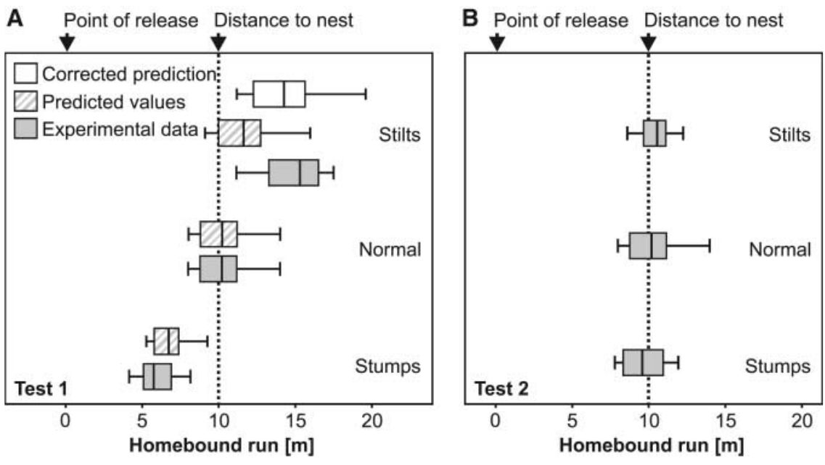
Stilts overshoot and stumps undershoot the nest
The transition from directed walking to repeated U-turns provides a behavioral measure of expected nest distance. Wittlinger and colleagues used the median of the first six turning points to locate the center of each ant's nest search. The measure turns a behavior into a number that can be compared across animals.
After a normal 10 m outbound journey, ants with lengthened legs searched at 15.30 m, ants with shortened legs searched at 5.75 m, and normal-legged controls searched at 10.20 m. The direction of each error followed the change in stride length. Stilts and stumps therefore pushed the expected distance in opposite directions from the true one.
Longer inbound strides made the stored journey terminate farther from release, while shorter strides made it terminate sooner. Debilitation would predict weaker searching, yet the animals walking on stilts overshot vigorously, so this bidirectional effect points to stride length. The search centers therefore sort by stride length. Each animal's search center therefore reflects its leg treatment.
Wittlinger et al. (2006), Fig. 3(A–B). Homing distances after leg manipulation and after matched outbound training.
Wittlinger et al. (2006)
10
Notes:
• The transition from directed walking to repeated U-turns provides a behavioral measure of expected nest distance. Wittlinger and colleagues used the median of the initial six turning points to identify the centre of an ant’s nest-search behavior.
• After a normal 10 m outbound journey, ants with lengthened legs searched at 15.30 m, ants with shortened legs searched at 5.75 m, and normal-legged controls searched at 10.20 m. The direction of the error followed the change in stride length.
• Longer inbound strides made the stored journey terminate farther from release, while shorter strides made it terminate sooner. This bidirectional effect is difficult to attribute solely to debilitation, which would not predict vigorous overshooting by the animals walking on stilts.
References:
Wittlinger M, Wehner R, Wolf H (2006). The Ant Odometer: Stepping on Stilts and Stumps. Science 312(5782):1965–1967. https://doi.org/10.1126/science.1126912
Figure: Wittlinger et al. (2006), Fig. 3(A–B). Homing distances after leg manipulation and after matched outbound training.
Figure source: https://doi.org/10.1126/science.1126912

Slide 14
Matched outward and inward legs restore homing distance
The same modified animal can experience a new outbound journey with the altered legs. This matched training keeps the manipulation present while removing the mismatch between the conditions used to acquire and to express the stored distance. The manipulation therefore stays constant across both journeys. Its stored distance is thus matched to its walking conditions.
After returning to the nest, ants walked to the feeder again on stilts or stumps and were retested. Their searches centered at 10.55 m for stilts and 10.25 m for stumps, close to the 10.20 m result for normal-legged controls and the true 10 m separation. Each retest used the leg condition the animal had experienced during its outbound walk.
Recovery of the expected distance supports a stride-dependent relationship between acquisition and readout, rather than permanent loss of navigation after surgery. The ant reaches the correct distance without measuring its leg length explicitly. The error therefore depends on journey history rather than on the surgery alone. The stored value is expressed in stride-based terms.
Wittlinger et al. (2006), Fig. 3(A–B). Homing distances after leg manipulation and after matched outbound training.
Wittlinger et al. (2006)
11
Notes:
• The same modified animal can experience a new outbound journey with the altered legs. This control keeps the manipulation present while removing the mismatch between the locomotor conditions used to acquire and express the stored distance.
• After returning to the nest, ants walked to the feeder again with their stilts or stumps and were retested. Searches centred at 10.55 m for stilts and 10.25 m for stumps, close to the 10.20 m normal-leg condition and the true 10 m separation.
• Recovery of the expected distance supports a stride-dependent acquisition-and-readout relationship rather than permanent loss of navigation after surgery. It does not require the ant to measure its leg length explicitly or identify which neural signal constitutes the odometer’s input.
References:
Wittlinger M, Wehner R, Wolf H (2006). The Ant Odometer: Stepping on Stilts and Stumps. Science 312(5782):1965–1967. https://doi.org/10.1126/science.1126912
Figure: Wittlinger et al. (2006), Fig. 3(A–B). Homing distances after leg manipulation and after matched outbound training.
Figure source: https://doi.org/10.1126/science.1126912

Slide 15
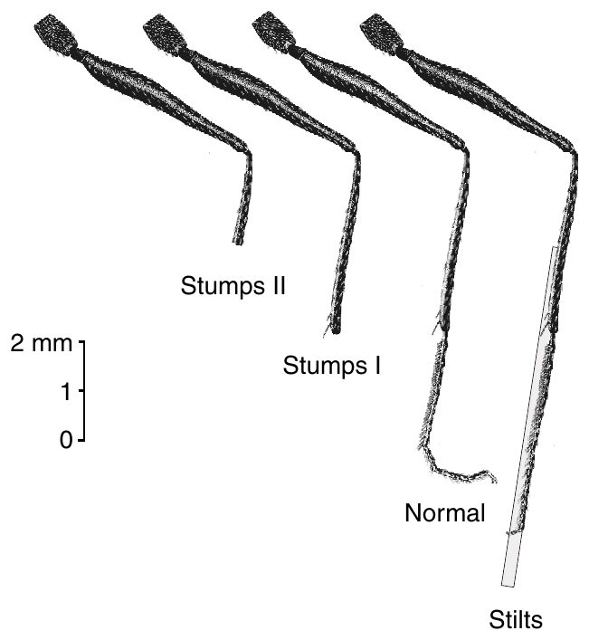
Two shortening treatments separate locomotor effects
Wittlinger and colleagues extended the odometer experiment with two degrees of leg shortening. Tarsomeres are the distal segments of an insect leg, and the tibia lies proximal to the tarsus. Removing either region changes the effective length of the walking limb. The two treatments therefore form a graded test of stride length.
The two shortening treatments removed different leg regions, and a third group carried bristle stilts. Normal-legged ants served as the reference group against which both shortened groups were measured. Each group was tested after its own leg manipulation. Stumps II therefore removed more of the limb than stumps I did.
The graded design measured different reductions in stride length rather than treating every shortened leg as one condition. Leg length, walking speed and load can change together, so the design tests a range of shortening rather than a single length. Each treatment therefore produced a distinct reduction in effective limb length.
Wittlinger et al. (2007), Fig. 2. Leg anatomy and the four length conditions.
Wittlinger et al. (2007)
12
Notes:
• Wittlinger and colleagues extended the odometer experiment with two degrees of leg shortening. **Tarsomeres** are the distal segments of an insect leg; the **tibia** lies proximal to the tarsus. Removing these regions changes the effective length of the walking limb.
• Stumps I lacked the distal tarsal segments, whereas stumps II had the distal half of the tibia removed. A third group carried bristle stilts, and normal-legged ants provided the comparison. All groups had acquired the same 10 m outbound feeder distance before the first test.
• The anatomically graded manipulation allowed comparison of different reductions in stride length rather than treating all shortened legs as one condition. It preserved a common navigational task, while acknowledging that leg length, walking speed and load can change together.
References:
Wittlinger M, Wehner R, Wolf H (2007). The desert ant odometer: a stride integrator that accounts for stride length and walking speed. Journal of Experimental Biology 210(2):198–207. https://doi.org/10.1242/jeb.02657
Figure: Wittlinger et al. (2007), Fig. 2. Leg anatomy and the four length conditions.
Figure source: https://doi.org/10.1242/jeb.02657

Slide 16
Graded shortening tests different leg reductions
Stumps I lacked the distal tarsal segments, whereas stumps II had the distal half of the tibia removed. The stilt group was lengthened with bristles, and normal-legged ants provided the reference for every group. Those leg changes were made at the feeder, after the outward distance had been learned.
All groups had acquired the same 10 m outbound feeder distance before the first test. The expanded experiment placed the normal-legged group at 10.20 m, the stumps-I group at 6.95 m and the stumps-II group at 5.75 m. The stilted group reached 15.30 m.
The video was recorded at 250 frames per second before and after each manipulation. The recorded strides were used to measure stride length and walking speed. Workers of larger size carry longer legs. The recorded strides supplied the stride frequency used in the analysis.
Wittlinger et al. (2007), Fig. 2. Leg anatomy and the four length conditions.
Wittlinger et al. (2007)
12a
Notes:
• Graded shortening tests different leg reductions.
• Explanation 1.
– Stumps I lacked the distal tarsal segments, whereas stumps II had the distal half of the tibia removed
– The stilt group was lengthened with bristles, and normal-legged ants provided the reference for every group. Those leg changes were made at the feeder, after the outward distance had been learned.
• Explanation 2.
– All groups had acquired the same 10 m outbound feeder distance before the first test
– The expanded experiment placed the normal-legged group at 10.20 m, the stumps-I group at 6.95 m and the stumps-II group at 5.75 m. The stilted group reached 15.30 m.
• Explanation 3.
– The video was recorded at 250 frames per second before and after each manipulation
– The recorded strides were used to measure stride length and walking speed. Workers of larger size carry longer legs. The recorded strides supplied the stride frequency used in the analysis.
• Source.
– The figure and the measurements come from Wittlinger et al. (2007).
– Each statement is tied to the recordings or observations of that study.
References:
Wittlinger M, Wehner R, Wolf H (2007). The desert ant odometer: a stride integrator that accounts for stride length and walking speed. Journal of Experimental Biology 210(2):198–207. https://doi.org/10.1242/jeb.02657

Slide 17
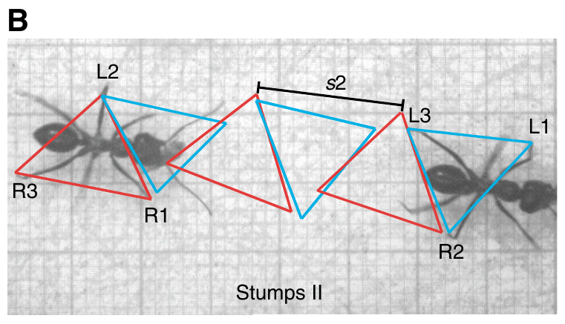
Shortened legs retain alternating tripod coordination
A tripod gait alternates two sets of three supporting legs. In Cataglyphis, one set combines the left front and hind legs with the right middle leg. The complementary set uses the remaining three legs. This alternating pattern keeps the body supported at every step. Those two sets are the building blocks of the stepping pattern.
The two sets of legs alternate with each step of the walk. Shortened legs did not change this basic alternation. The published normal example had a stride length of 13.3 mm at 0.28 m/s. A stumps-II example kept its tripods with a 10.5 mm stride at 0.27 m/s. This alternation persists after the manipulation.
Preserved tripods constrain explanations that would require an entirely different gait after shortening. Changes in stride length therefore occur within an ordinary tripod rhythm. The walking cycle keeps its basic coordination pattern. The spatial extent of each cycle is the part that changes. The leg manipulation changes the stride, not the pattern of support.
Wittlinger et al. (2007), Fig. 3(B). Tripod gait after shortening the tibiae.
Wittlinger et al. (2007)
13
Notes:
• A **tripod gait** alternates two sets of three supporting legs. In Cataglyphis, one set combines the left front and hind legs with the right middle leg; the complementary set uses the remaining three legs.
• High-speed video at 250 frames per second recorded ants before and after manipulation. The published normal example had a stride length of 13.3 mm at 0.28 m/s, whereas a stumps-II example retained tripod coordination with a 10.5 mm stride at 0.27 m/s.
• The observations separate shortening of the walking cycle’s spatial extent from replacement of its basic coordination pattern. Preserved tripods do not establish unchanged sensory feedback or motor-neuron activity, but they constrain explanations that require an entirely different gait after shortening.
References:
Wittlinger M, Wehner R, Wolf H (2007). The desert ant odometer: a stride integrator that accounts for stride length and walking speed. Journal of Experimental Biology 210(2):198–207. https://doi.org/10.1242/jeb.02657
Figure: Wittlinger et al. (2007), Fig. 3(B). Tripod gait after shortening the tibiae.
Figure source: https://doi.org/10.1242/jeb.02657

Slide 18
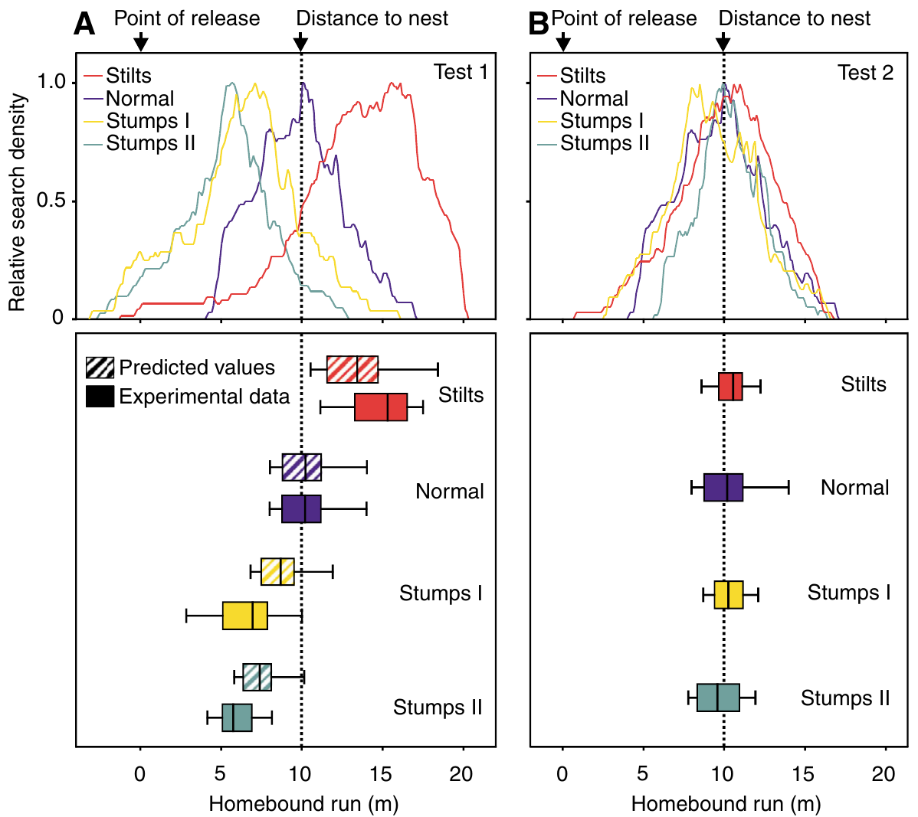
Distance errors track the extent of leg shortening
A shorter stride covers less ground during each locomotor cycle. If outbound distance is stored in relation to movement cycles, shortening the legs after that journey makes the inbound estimate terminate before the original feeder-to-nest distance. The estimate is set by the cycles the ant completes, not by the metres it covers.
In the expanded experiment, normal-legged ants searched at 10.20 m, stumps-I ants at 6.95 m and stumps-II ants at 5.75 m. Stilts produced searches at 15.30 m. Each shortening treatment produced an undershoot relative to the controls. Stumps II, with the larger removal, produced the shorter search. The stumps-I searches fell between those of stumps II and normal legs.
The graded undershoot fits a stride integrator more closely than a fixed physical-distance readout independent of locomotion. Both shortening treatments changed more than one biomechanical variable. The authors therefore measured stride kinematics to test the quantitative prediction. The undershoot therefore reflects the stride geometry of each treatment. Both points come from the same channel experiment.
Wittlinger et al. (2007), Fig. 4(A–B). Color-coded searches before and after matched leg-length training.
Wittlinger et al. (2007)
14
Notes:
• A shorter stride covers less ground during each locomotor cycle. If outbound distance is stored in relation to movement cycles, shortening the legs only after that journey should make the inbound estimate terminate before the original feeder-to-nest distance.
• In the expanded experiment, normal-legged ants searched at 10.20 m, stumps-I ants at 6.95 m and stumps-II ants at 5.75 m. Stilts produced searches at 15.30 m. These values were measured after a 10 m outbound run through the training channel.
• The graded undershoot is consistent with a stride integrator rather than a fixed physical-distance readout independent of locomotion. The two shortening treatments nevertheless changed more than one biomechanical variable, so recorded stride kinematics were needed to assess the quantitative prediction.
References:
Wittlinger M, Wehner R, Wolf H (2007). The desert ant odometer: a stride integrator that accounts for stride length and walking speed. Journal of Experimental Biology 210(2):198–207. https://doi.org/10.1242/jeb.02657
Figure: Wittlinger et al. (2007), Fig. 4(A–B). Color-coded searches before and after matched leg-length training.
Figure source: https://doi.org/10.1242/jeb.02657

Slide 19
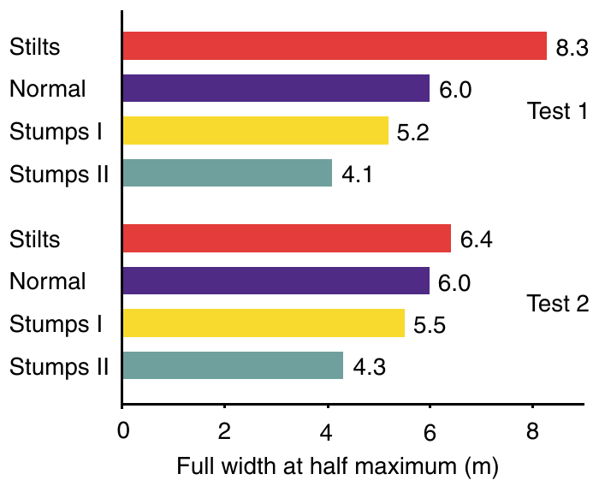
Search density distinguishes distance from uncertainty
A search density distribution records how often an ant visits each position during its search. Its center estimates the expected nest location. Its width describes how broadly the animal spreads its search around that estimate. Both properties come from one search record. The center and width therefore give two readouts of one search record.
The distributions differed in spread as well as in center across the four leg conditions. Shorter legs produced narrower searches. The width ranks the four conditions in the same order as the stride treatments. The spread therefore carries information about stride length. The stilted animals searched across the widest range of positions.
Longer strides spread the search over more ground, and shorter strides concentrate it. The widths describe searching behavior rather than a direct measurement of a neural uncertainty variable. Each stride sets how much ground a single cycle covers. Stride length therefore sets the spatial extent of the search. The widths therefore follow the stride treatments directly.
Wittlinger et al. (2007), Fig. 5. Widths of the nest-search distributions.
Wittlinger et al. (2007)
15
Notes:
• A **search density distribution** records how often an ant visits positions during its search. Its centre estimates expected nest location, while its width describes how broadly the animal distributes its search around that estimate.
• The test channel was divided into 10 cm bins. In the first test, the full width at half maximum was 8.3 m for stilts, 6.0 m for normal legs, 5.2 m for stumps I and 4.1 m for stumps II. The plotted search curves therefore differed in spread as well as centre.
• The widths are behavioral descriptions of searching rather than direct measurements of a neural uncertainty variable. Longer or shorter strides alter the spatial extent covered during searching, so distribution width cannot by itself establish how precisely a central memory encodes distance.
References:
Wittlinger M, Wehner R, Wolf H (2007). The desert ant odometer: a stride integrator that accounts for stride length and walking speed. Journal of Experimental Biology 210(2):198–207. https://doi.org/10.1242/jeb.02657
Figure: Wittlinger et al. (2007), Fig. 5. Widths of the nest-search distributions.
Figure source: https://doi.org/10.1242/jeb.02657

Slide 20
Search width tracks the stride-determined spread
The test channel was divided into 10 cm bins before the search data were analyzed. In the first test, the full width at half maximum was 8.3 m for stilts, 6.0 m for normal legs, 5.2 m for stumps I and 4.1 m for stumps II. The search distributions were then plotted for each leg condition.
Stilts had the widest distribution of the four conditions, and stumps II had the narrowest. The four widths follow the same order as the leg treatments that produced them. Search centers for the same conditions were 15.30 m for stilts and 10.20 m for normal legs. The stump-II searches covered the least ground of the four conditions.
Searches in the first test were measured before any matched training, so these widths describe the initial mismatch. Repeated outbound training changed the distributions in the second test. Those widths are full widths at half maximum, reported in meters.
Wittlinger et al. (2007), Fig. 5. Widths of the nest-search distributions.
Wittlinger et al. (2007)
15a
Notes:
• Search width tracks the stride-determined spread.
• Explanation 1.
– The test channel was divided into 10 cm bins before the search data were analyzed
– In the first test, the full width at half maximum was 8.3 m for stilts, 6.0 m for normal legs, 5.2 m for stumps I and 4.1 m for stumps II. The search distributions were then plotted for each leg condition.
• Explanation 2.
– Stilts had the widest distribution of the four conditions, and stumps II had the narrowest
– The four widths follow the same order as the leg treatments that produced them. Search centers for the same conditions were 15.30 m for stilts and 10.20 m for normal legs. The stump-II searches covered the least ground of the four conditions.
• Explanation 3.
– Searches in the first test were measured before any matched training, so these widths describe the initial mismatch
– Repeated outbound training changed the distributions in the second test. Those widths are full widths at half maximum, reported in meters.
• Source.
– The figure and the measurements come from Wittlinger et al. (2007).
– Each statement is tied to the recordings or observations of that study.
References:
Wittlinger M, Wehner R, Wolf H (2007). The desert ant odometer: a stride integrator that accounts for stride length and walking speed. Journal of Experimental Biology 210(2):198–207. https://doi.org/10.1242/jeb.02657

Slide 21
Repeated training removes most of the distance mismatch
Comparing the first and second tests distinguishes a newly imposed mismatch from walking with altered legs on both journey directions. In the second test, ants had left the nest and reached the feeder using the same modified limbs they used during homing. The second test therefore evaluates walking under the legs used for homing.
The initial stilt and stump searches were displaced from the 10 m nest distance. After the subsequent outbound journey, the search distributions clustered near the correct distance across all four leg conditions. The four conditions converged on the same distance. Stilts, stumps and normal legs all ended up near the same correct distance.
The dependence on journey history points to a stride-associated mechanism rather than a persistent injury. Matched locomotor conditions permit accurate homing. A physiological integrator of stride-associated signals can produce the same relationship between acquisition and return. Walking with the same legs, the ant recovers the distance. The result distinguishes a stride-associated mechanism from a lasting physical injury.
Wittlinger et al. (2007), Fig. 4(A–B). Color-coded searches before and after matched leg-length training.
Wittlinger et al. (2007)
16
Notes:
• Comparing first and second tests separates a newly imposed mismatch from walking with altered legs on both journey directions. In the second test, ants had left the nest and reached the feeder using the same modified limbs used during homing.
• The initial stilt and stump searches were displaced from the 10 m nest distance. After the subsequent outbound journey, the color-coded search distributions clustered near the correct distance across the four leg conditions, even though the surgical or bristle modifications remained present.
• The dependence on journey history makes a persistent injury explanation insufficient. Matched locomotor conditions permit accurate homing without proving a numerical step counter; a physiological integrator of stride-associated signals can produce the same qualitative relationship between acquisition and return.
References:
Wittlinger M, Wehner R, Wolf H (2007). The desert ant odometer: a stride integrator that accounts for stride length and walking speed. Journal of Experimental Biology 210(2):198–207. https://doi.org/10.1242/jeb.02657
Figure: Wittlinger et al. (2007), Fig. 4(A–B). Color-coded searches before and after matched leg-length training.
Figure source: https://doi.org/10.1242/jeb.02657

Slide 22
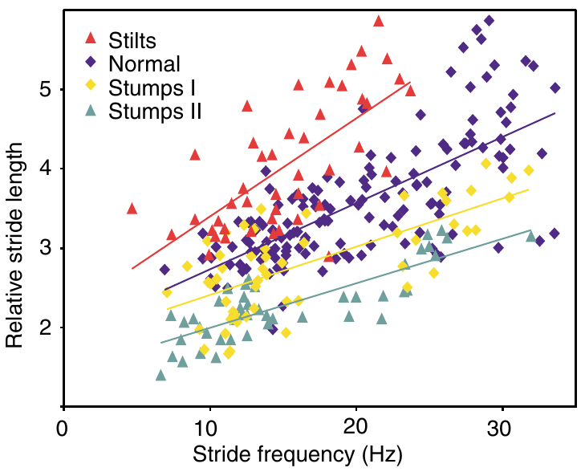
Body size must be separated from stride length
Larger Cataglyphis workers have longer legs and can take longer strides. Normalization expresses measurements relative to a specified reference. Body-size differences are thereby separated from the effects of the experimental manipulation. This removes body size as a confound. Normalizing removes body size as a source of variation in the plot.
Wittlinger and colleagues expressed middle-leg length and stride length relative to alitrunk length, the thoracic region between the pronotum and propodeum. High-speed records related these relative strides to stride frequency. Each animal's own alitrunk length supplies the reference. Those relative strides were then plotted against frequency for each animal group.
The analysis places normal, stilt and stump animals on a common anatomical and locomotor basis. Relative stride length is dimensionless in the relevant plot. That property makes it readable across animals of different sizes. This allows direct comparison across the groups. Each group is therefore measured on one scale. The plot therefore places every animal on a common axis.
Wittlinger et al. (2007), Fig. 6. Stride length as a function of stride frequency.
Wittlinger et al. (2007)
17
Notes:
• Larger Cataglyphis workers have longer legs and can take longer strides. **Normalization** expresses measurements relative to a specified reference so that differences in body size do not masquerade as effects of the experimental manipulation.
• Wittlinger and colleagues measured the **alitrunk**, the thoracic region between the pronotum and propodeum, and expressed middle-leg length and stride length relative to alitrunk length. High-speed records related these relative strides to frequency, including a comparison at 20 Hz.
• The analysis placed normal, stilt and stump animals on a common anatomical and locomotor basis. Relative stride length is therefore dimensionless in the relevant plot; it is not a second independently measured estimate of homing distance or evidence that ants themselves perform this normalization.
References:
Wittlinger M, Wehner R, Wolf H (2007). The desert ant odometer: a stride integrator that accounts for stride length and walking speed. Journal of Experimental Biology 210(2):198–207. https://doi.org/10.1242/jeb.02657
Figure: Wittlinger et al. (2007), Fig. 6. Stride length as a function of stride frequency.
Figure source: https://doi.org/10.1242/jeb.02657

Slide 23
Stride length varies even at a common cycle frequency
Stride frequency is the number of complete leg cycles per second, measured in hertz. It is distinct from stride length, the distance advanced during one cycle. Either variable can change walking speed. Each variable is measured separately in the analysis. Measuring both variables separately is necessary for the analysis. A change in speed can come from either variable.
At comparable frequencies, stilt ants had longer relative strides and stump ants shorter relative strides than controls. The profiles differ systematically by leg condition. Each leg condition therefore has its own frequency-length profile. These differences are measurable at a common frequency. Stilted ants therefore covered more distance per cycle than controls.
The measured relationships link the imposed limb geometry to locomotor displacement. They give a quantitative target for any model of the odometer. The odometer's inputs must therefore match these curves. They set the standard that the odometer's inputs must meet. The stride-based account must therefore agree with each measured curve.
Wittlinger et al. (2007), Fig. 6. Stride length as a function of stride frequency.
Wittlinger et al. (2007)
18
Notes:
• **Stride frequency** is the number of complete leg cycles per second, measured in hertz. It is distinct from stride length, the distance advanced during one cycle. Either variable can change walking speed.
• At comparable frequencies, stilt ants had longer relative strides and stump ants shorter relative strides than controls. The investigators used the measured frequency–length relationships to compare animals at 20 Hz, reducing the effect of unequal movement speeds on the predicted homing distances.
• The remaining ordering of the leg conditions links the imposed limb geometry to locomotor displacement. The measured relationships provide a quantitative behavioral constraint, but they do not reveal whether the odometer receives cycle counts, proprioceptive signals or an integrated motor command.
References:
Wittlinger M, Wehner R, Wolf H (2007). The desert ant odometer: a stride integrator that accounts for stride length and walking speed. Journal of Experimental Biology 210(2):198–207. https://doi.org/10.1242/jeb.02657
Figure: Wittlinger et al. (2007), Fig. 6. Stride length as a function of stride frequency.
Figure source: https://doi.org/10.1242/jeb.02657

Slide 24
Stride frequency and length measured at 20 Hz
Stride frequency and stride length are measured separately in the analysis, and either one can change walking speed. Comparing animals at 20 Hz reduced the effect of unequal movement speeds on the predicted homing distances. The analysis used straight runs without abrupt stops. The analysis compared the leg conditions at 20 Hz, which is 20 cycles per second.
Stride length was expressed relative to the alitrunk, a body-size reference. The high-speed records then linked those relative strides with frequency, including the 20 Hz analysis. The curves for stilts, stumps and normal legs were read at matching frequencies.
The stride-length relationship was established independently of the turning-point measures used to locate each ant's nest search. Stilt ants showed longer strides at matched speeds, and stump ants showed shorter ones. Those measures came from freely walking animals. Each leg condition produced its own frequency-length curve.
Wittlinger et al. (2007), Fig. 6. Stride length as a function of stride frequency.
Wittlinger et al. (2007)
18a
Notes:
• Stride frequency and length measured at 20 Hz.
• Explanation 1.
– Stride frequency and stride length are measured separately in the analysis, and either one can change walking speed
– Comparing animals at 20 Hz reduced the effect of unequal movement speeds on the predicted homing distances. The analysis used straight runs without abrupt stops. The analysis compared the leg conditions at 20 Hz, which is 20 cycles per second.
• Explanation 2.
– Stride length was expressed relative to the alitrunk, a body-size reference
– The high-speed records then linked those relative strides with frequency, including the 20 Hz analysis. The curves for stilts, stumps and normal legs were read at matching frequencies.
• Explanation 3.
– The stride-length relationship was established independently of the turning-point measures used to locate each ant's nest search
– Stilt ants showed longer strides at matched speeds, and stump ants showed shorter ones. Those measures came from freely walking animals. Each leg condition produced its own frequency-length curve.
• Source.
– The figure and the measurements come from Wittlinger et al. (2007).
– Each statement is tied to the recordings or observations of that study.
References:
Wittlinger M, Wehner R, Wolf H (2007). The desert ant odometer: a stride integrator that accounts for stride length and walking speed. Journal of Experimental Biology 210(2):198–207. https://doi.org/10.1242/jeb.02657

Slide 25
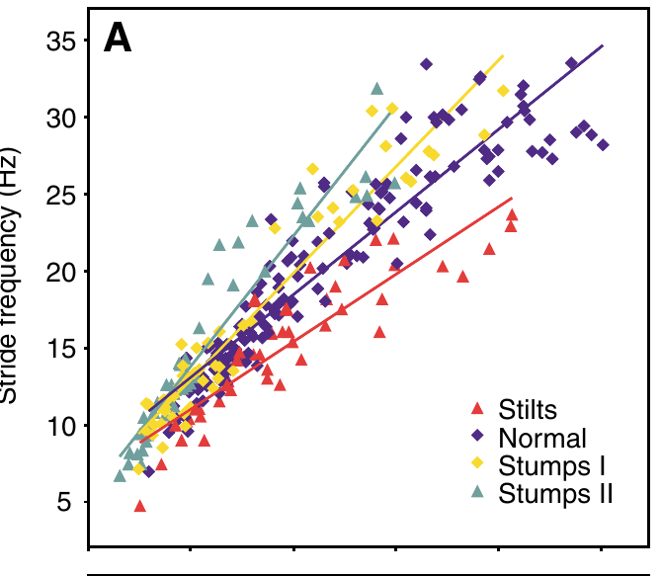
Walking speed is not determined by frequency alone
Increasing walking speed can involve faster cycles, longer strides, or both. Wittlinger and colleagues recorded freely walking animals under several temperature and preparation conditions. The analysis retained straight runs without abrupt stops. Speed was measured in millimeters per second in the analysis. The analysis excluded any run with abrupt stops.
The color-coded data relate walking speed to stride frequency. Normal and shortened-leg ants increased cycle frequency as speed rose. Stilted ants used lower frequencies for a given speed. Stride length carried the rest of the speed change, so the two variables offset each other. Those frequency patterns separate the leg conditions.
A time-based explanation has to use measured speeds, since manipulated ants may differ in cycle rate and velocity. Elapsed journey time translates into distance only through the measured relationship between speed and stride. Distance follows from speed and stride, not from time alone. Two animals walking at the same speed may cover different distances.
Wittlinger et al. (2007), Fig. 7(A). Stride frequency increases with walking speed.
Wittlinger et al. (2007)
19
Notes:
• Increasing walking speed can involve faster cycles, longer strides, or both. Wittlinger and colleagues recorded freely walking animals under several temperature and preparation conditions, retaining straight runs without abrupt stops for the kinematic comparisons.
• The color-coded data related walking speed, in mm/s, to stride frequency, in Hz. Normal and shortened-leg ants increased cycle frequency as speed increased, while stilts tended to use lower frequencies for a given speed. Their longer strides partly compensated for the reduced frequency.
• These relationships prevent interpreting every change in elapsed journey time as a proportional change in distance. A time-based explanation must account for the actual measured speeds rather than assume that all manipulated ants maintain the same cycle rate or velocity.
References:
Wittlinger M, Wehner R, Wolf H (2007). The desert ant odometer: a stride integrator that accounts for stride length and walking speed. Journal of Experimental Biology 210(2):198–207. https://doi.org/10.1242/jeb.02657
Figure: Wittlinger et al. (2007), Fig. 7(A). Stride frequency increases with walking speed.
Figure source: https://doi.org/10.1242/jeb.02657

Slide 26
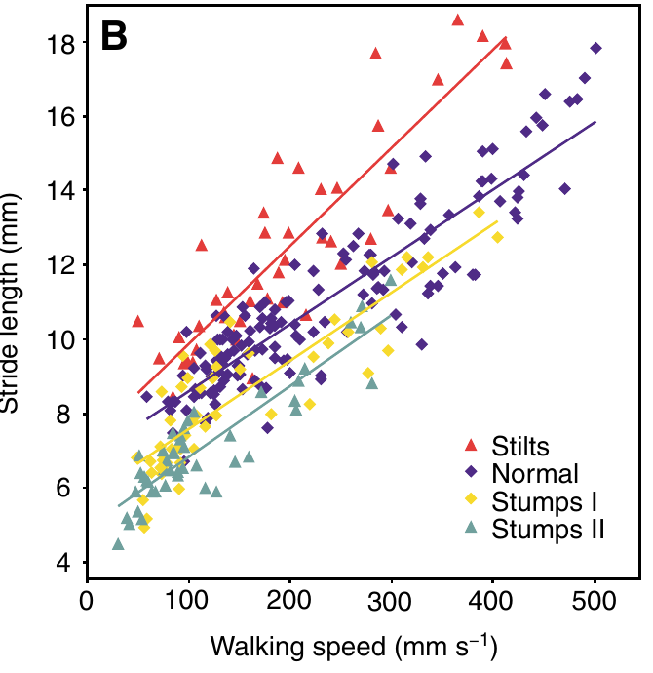
Stride length also increases with walking speed
The distance advanced during one stride varies with the leg condition and with walking speed. Cataglyphis lengthens its stride as it runs faster. The effect of altered limb length has to be evaluated across measured locomotor speeds. A single fixed step size would misrepresent the walk. This dependence is measured across the speed range.
The published plot relates stride length to walking speed. Stilted ants had longer strides than controls at comparable speeds. Stumped ants had shorter strides. High-speed recordings measured stride length and speed directly for each animal. This makes stride length a measured variable rather than an assumption. The plot covers several speeds in each condition.
The agreement between locomotor displacement and homing bias supports stride-based odometry without assuming one unchanging step size. The stride-length term therefore sits alongside heading information in the homing computation. Both inputs are needed to explain the observed bias. Stride length enters the homing computation as a measured quantity. This keeps the odometer tied to measured locomotion.
Wittlinger et al. (2007), Fig. 7(B). Stride length increases with walking speed.
Wittlinger et al. (2007)
20
Notes:
• The distance advanced during one stride is not a fixed constant for a leg condition. Cataglyphis changes stride length as it runs faster, so the effect of altered limb length must be evaluated across measured locomotor speeds.
• The published plot relates stride length in mm to walking speed in mm/s. Stilts have longer strides than controls at comparable speeds, and stumps shorter strides. High-speed recordings establish this relationship independently of the turning-point measures used to locate each ant’s nest search.
• The agreement between locomotor displacement and homing bias supports stride-based odometry while avoiding an assumption of one unchanging step size. The measurements still leave unresolved how stride-length information is represented and combined with heading information in the nervous system.
References:
Wittlinger M, Wehner R, Wolf H (2007). The desert ant odometer: a stride integrator that accounts for stride length and walking speed. Journal of Experimental Biology 210(2):198–207. https://doi.org/10.1242/jeb.02657
Figure: Wittlinger et al. (2007), Fig. 7(B). Stride length increases with walking speed.
Figure source: https://doi.org/10.1242/jeb.02657

Slide 27
A stride integrator need not be a literal counter
A stride integrator accumulates information tied to rhythmic locomotion, so footfalls can accumulate without being counted as separate objects. Possible inputs include proprioception, which is sensory information about limb position and movement. Footfalls are therefore summed as a rhythmic signal, not counted one at a time. This rhythmic input is what the odometer reads.
The preserved tripod pattern and the graded stride changes both fit accumulation of movement-linked information rather than a fixed elapsed-time rule. Those findings favor this account over a clock-based one. The navigation task stayed the same across all leg conditions, which isolates the stride effect. Only stride-based accumulation changes when the leg length changes.
Proprioception, central rhythm-generating activity and motor commands are the candidate sources of this information. No transmitter, receptor or ion channel has been identified as the odometer mechanism. These candidates are therefore proposed explanations. Each candidate needs its own targeted test. Each candidate needs its own targeted test before a mechanism is assigned.
Wittlinger et al. (2007), Fig. 3(A). Normal tripod gait in a walking Cataglyphis fortis.
Wittlinger et al. (2007)
21
Notes:
• A **stride integrator** accumulates information associated with rhythmic locomotion. It need not register each footfall as a discrete counted object. Possible inputs include **proprioception**, sensory information about limb position and movement, or activity associated with generating the walking rhythm.
• The 2007 experiments combined a 10 m navigational task with 250-frame-per-second video and leg-length manipulations. Both the preserved tripod pattern and the graded stride changes were consistent with accumulation of movement-linked information rather than a fixed elapsed-time rule.
• The physiological alternatives were not directly recorded or selectively blocked in this study. No transmitter, receptor or ion channel was identified as the odometer mechanism, so these candidates remain proposed explanations rather than established cellular findings in Cataglyphis.
References:
Wittlinger M, Wehner R, Wolf H (2007). The desert ant odometer: a stride integrator that accounts for stride length and walking speed. Journal of Experimental Biology 210(2):198–207. https://doi.org/10.1242/jeb.02657
Figure: Wittlinger et al. (2007), Fig. 3(A). Normal tripod gait in a walking Cataglyphis fortis.
Figure source: https://doi.org/10.1242/jeb.02657

Slide 28
Accumulated movement signals fit a stride integrator
The 2007 experiment combined a 10 m navigational task with leg-length manipulations. In that experiment the leg conditions were stilts, stumps and normal legs. The 2007 paper's title describes a stride integrator that accounts for both stride length and walking speed.
Stilted animals searched at 15.30 m after a 10 m outbound journey, while shortened-leg animals searched at 5.75 m. The search centers came from the middle value of the initial six turning points. Both values came from searches after the same 10 m outbound run.
After one more outbound walk, the searches for all four leg conditions converged on the correct 10 m distance. Stride length was plotted against walking speed in millimeters per second, and the kinematic analysis measured both for each animal.
Wittlinger et al. (2007), Fig. 3(A). Normal tripod gait in a walking Cataglyphis fortis.
Wittlinger et al. (2007)
21a
Notes:
• Accumulated movement signals fit a stride integrator.
• Explanation 1.
– The 2007 experiment combined a 10 m navigational task with leg-length manipulations
– In that experiment the leg conditions were stilts, stumps and normal legs. The 2007 paper's title describes a stride integrator that accounts for both stride length and walking speed.
• Explanation 2.
– Stilted animals searched at 15.30 m after a 10 m outbound journey, while shortened-leg animals searched at 5.75 m
– The search centers came from the middle value of the initial six turning points. Both values came from searches after the same 10 m outbound run.
• Explanation 3.
– After one more outbound walk, the searches for all four leg conditions converged on the correct 10 m distance
– Stride length was plotted against walking speed in millimeters per second, and the kinematic analysis measured both for each animal.
• Source.
– The figure and the measurements come from Wittlinger et al. (2007).
– Each statement is tied to the recordings or observations of that study.
References:
Wittlinger M, Wehner R, Wolf H (2007). The desert ant odometer: a stride integrator that accounts for stride length and walking speed. Journal of Experimental Biology 210(2):198–207. https://doi.org/10.1242/jeb.02657

Slide 29
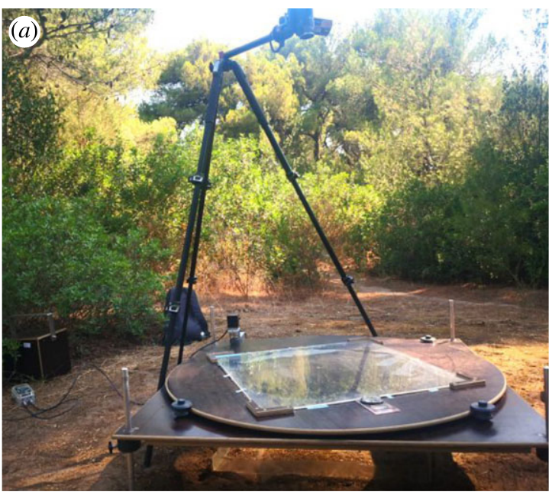
Learning walks precede long-distance foraging
Learning walks are short excursions around the nest during the transition from interior work to outside foraging. Cataglyphis nodus repeatedly pauses and rotates during these walks. The ants gather experience with directional and visual information before they make distant journeys. Learning walks therefore link the first experiences of the nest surroundings to later foraging.
Grob and colleagues tested novice ants around natural nests in Greece. A polarization filter was held over a learning-walk area. The ants experienced defined skylight conditions over three days before their brains were analyzed. The filter was held in place, so polarization stayed fixed. The filter restricted the polarization information available to the novices.
The field setup keeps natural behavior near the home nest while manipulating one component of the compass environment. The structural outcome of that experience can be measured in the brain. The design therefore links daily learning to anatomy. The learning experience is linked to a structural endpoint rather than to later success.
Grob et al. (2022), Fig. 1(a). The polarization-filter apparatus in the natural habitat.
Grob et al. (2022)
22
Notes:
• **Learning walks** are short excursions around the nest during the transition from interior work to outside foraging. Cataglyphis nodus repeatedly pauses and rotates during these walks, acquiring experience with directional and visual information before taking distant journeys.
• Grob and colleagues tested novices around natural nests in Greece. A table installed 30 cm above the entrance held a polarization filter over a 60 × 60 cm learning-walk area. Ants experienced defined skylight conditions over three days before their brains were analyzed.
• The field preparation retained active behavior near the home nest while manipulating one component of the compass environment. It tests experience-dependent structural change; it does not directly measure a complete home vector in an identified neuron or establish each novice’s later foraging success.
References:
Grob R, Holland Cunz O, Grübel K, Pfeiffer K, Rössler W, Fleischmann PN (2022). Rotation of skylight polarization during learning walks is necessary to trigger neuronal plasticity in Cataglyphis ants. Proceedings of the Royal Society B 289:20212499. https://doi.org/10.1098/rspb.2021.2499
Figure: Grob et al. (2022), Fig. 1(a). The polarization-filter apparatus in the natural habitat.
Figure source: https://doi.org/10.1098/rspb.2021.2499

Slide 30
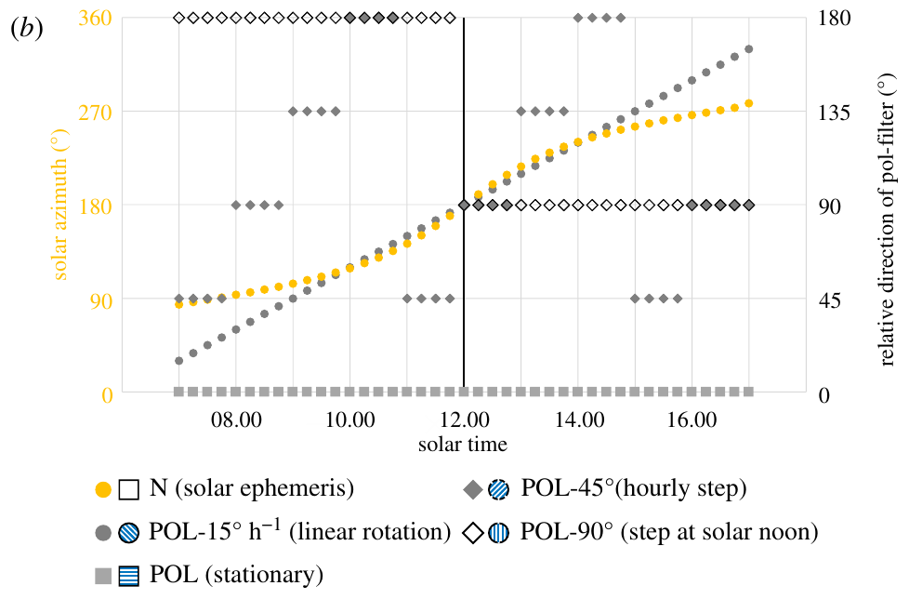
Sky polarization supplies a changing compass reference
The solar ephemeris is the sun's changing position over the day. A time-compensated sky compass must relate current solar or polarization information to heading despite that movement. Initial learning can establish that relation between celestial changes and stable surroundings. The compass must therefore calibrate its reference over the day. The sun's apparent path changes continuously during the day.
Grob and colleagues tested natural skylight alongside a stationary polarizer, a single 90° turn at solar noon, hourly 45° turns, and continuous rotation at 15° per hour. Each treatment set how the polarization direction changed during three days of learning walks. Continuous rotation advanced the filter more slowly than the hourly steps did.
The artificial schedules isolate experience of a changing polarization pattern from simple exposure to polarized light. They are controlled experimental cues rather than exact copies of the natural sky. They are chosen to isolate change, not to mimic the sky. They therefore make the rate of change a controlled variable. Each schedule was run over the same three days.
Grob et al. (2022), Fig. 1(b). Stationary, stepped and continuously rotating polarization treatments.
Grob et al. (2022)
23
Notes:
• The **solar ephemeris** is the sun’s changing position over the day. A time-compensated sky compass must relate current solar or polarization information to heading despite that movement. Initial learning can establish the relation between celestial changes and stable surroundings.
• Grob and colleagues compared natural skylight with a stationary polarizer, a single 90° turn at solar noon, hourly 45° turns, and continuous rotation at 15° per hour. Each treatment constrained how polarization direction changed during three days of learning walks.
• The artificial schedules separated exposure to polarized light from experience of a changing polarization pattern. They were controlled experimental cues rather than claims that the natural sky everywhere follows those exact angular steps, especially near noon or at different geographical positions.
References:
Grob R, Holland Cunz O, Grübel K, Pfeiffer K, Rössler W, Fleischmann PN (2022). Rotation of skylight polarization during learning walks is necessary to trigger neuronal plasticity in Cataglyphis ants. Proceedings of the Royal Society B 289:20212499. https://doi.org/10.1098/rspb.2021.2499
Figure: Grob et al. (2022), Fig. 1(b). Stationary, stepped and continuously rotating polarization treatments.
Figure source: https://doi.org/10.1098/rspb.2021.2499

Slide 31
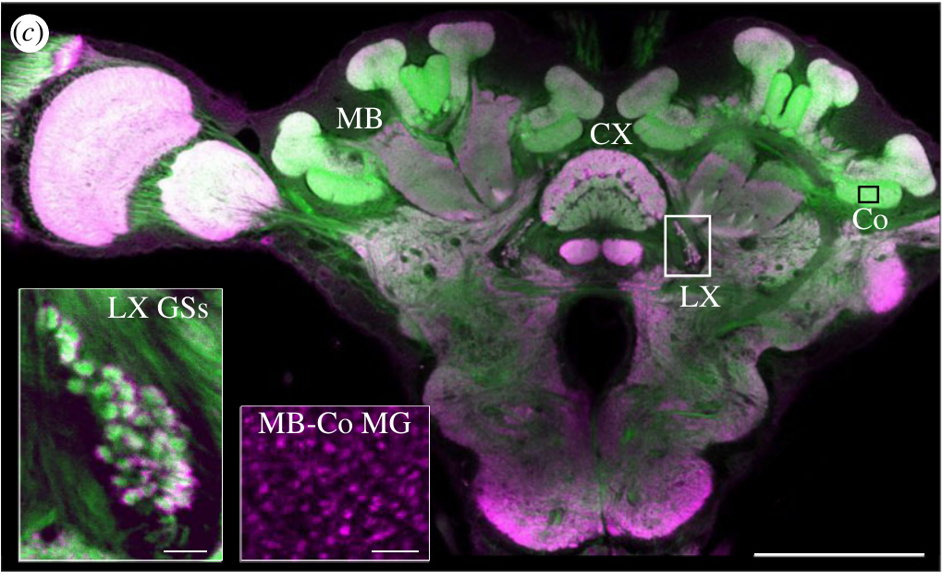
Two visual pathways reach different integration centres
A neuropil is a region containing neuronal processes and synapses. The central complex comprises midline neuropils implicated in heading and navigation. The mushroom bodies are paired structures implicated in memory-based processing. These structures are the targets of the mapping. Both neuropils therefore carry processes and synapses that can be counted.
Grob and colleagues examined synaptic structures in both pathways of the same brains. The central complex and the mushroom-body collar receive visual information through different routes. Those labels were applied to the same brains, allowing a direct comparison of the two regions. Those labels reveal the synaptic structures in each region.
The anatomical distinction permits separate measurements along the two visual pathways. Labeling synaptic structures establishes their position and morphology. Each pathway therefore supplies its own anatomical measure. Position, morphology and count can all be recorded for each pathway. The two measurements are made on the same brains. Both measures are made on the same brains.
Grob et al. (2022), Fig. 1(c). Central complex, lateral complex and mushroom-body synaptic anatomy.
Grob et al. (2022)
24
Notes:
• A **neuropil** is a region containing neuronal processes and synapses. The **central complex** comprises midline brain neuropils implicated in heading and navigation, while the **mushroom bodies** are paired structures implicated in memory-based processing.
• Grob and colleagues labelled Cataglyphis brains with anti-synapsin antibodies and fluorescent phalloidin, which marks actin-rich structures. Their preparations identified mushroom-body collar microglomeruli and giant synapses in the lateral complex. The whole-brain image has a 200 µm scale bar and the synaptic insets 10 µm bars.
• The anatomical distinction permits separate measurements along the two visual pathways. Labelling synaptic structures establishes their position and morphology, but neither stain reports the sign of a postsynaptic voltage change, an active compass heading or a stored navigational distance.
References:
Grob R, Holland Cunz O, Grübel K, Pfeiffer K, Rössler W, Fleischmann PN (2022). Rotation of skylight polarization during learning walks is necessary to trigger neuronal plasticity in Cataglyphis ants. Proceedings of the Royal Society B 289:20212499. https://doi.org/10.1098/rspb.2021.2499
Figure: Grob et al. (2022), Fig. 1(c). Central complex, lateral complex and mushroom-body synaptic anatomy.
Figure source: https://doi.org/10.1098/rspb.2021.2499

Slide 32
Lateral-complex synapses respond to light exposure
The whole-brain image in the published figure has a 200 µm scale bar, and the synaptic insets have 10 µm bars. Giant-synapse numbers in the lateral complex rose after three days of exposure to full-spectrum light, with no learning walks required. Both scales appear in the same figure panel.
Removing ultraviolet light lowered that rise. Ants given full-spectrum light without learning walks still showed the increase. Dark controls provided the reference level for each light treatment. The experiment ran for three days before the brains were analyzed.
Central-complex volume did not follow this light-driven pattern. The light treatments were natural skylight, a filter that removed ultraviolet, and a fixed polarization pattern. Lateral-complex synapses sit along the sky-compass pathway in these ants. The lateral complex is a region of the visual pathway that the study counted synapses in.
Grob et al. (2022), Fig. 1(c). Central complex, lateral complex and mushroom-body synaptic anatomy.
Grob et al. (2022)
24a
Notes:
• Lateral-complex synapses respond to light exposure.
• Explanation 1.
– The whole-brain image in the published figure has a 200 µm scale bar, and the synaptic insets have 10 µm bars
– Giant-synapse numbers in the lateral complex rose after three days of exposure to full-spectrum light, with no learning walks required. Both scales appear in the same figure panel.
• Explanation 2.
– Removing ultraviolet light lowered that rise
– Ants given full-spectrum light without learning walks still showed the increase. Dark controls provided the reference level for each light treatment. The experiment ran for three days before the brains were analyzed.
• Explanation 3.
– Central-complex volume did not follow this light-driven pattern
– The light treatments were natural skylight, a filter that removed ultraviolet, and a fixed polarization pattern. Lateral-complex synapses sit along the sky-compass pathway in these ants. The lateral complex is a region of the visual pathway that the study counted synapses in.
• Source.
– The figure and the measurements come from Grob et al. (2022).
– Each statement is tied to the recordings or observations of that study.
References:
Grob R, Holland Cunz O, Grübel K, Pfeiffer K, Rössler W, Fleischmann PN (2022). Rotation of skylight polarization during learning walks is necessary to trigger neuronal plasticity in Cataglyphis ants. Proceedings of the Royal Society B 289:20212499. https://doi.org/10.1098/rspb.2021.2499

Slide 33
Synaptic labels distinguish boutons from target processes
Synapsin is a protein associated with presynaptic vesicles, so anti-synapsin labeling helps identify presynaptic specializations. F-actin is filamentous actin, and fluorescent phalloidin labels it in neuronal processes. The two labels therefore mark different sides of each connection. Both labels are needed to read each connection. Each one adds different information.
The Cataglyphis nodus preparations quantified microglomeruli, which are compact synaptic complexes in the mushroom-body collar. The preparations also quantified giant synapses in the lateral complex. Each structure type was tallied separately within its own region. Synapsin and actin labels were combined for every count. Each count was made within its own brain region.
Structural counts can reveal experience-associated reorganization of synapses. The endpoints were the number and form of synaptic complexes. Measures of transmitter release and synaptic current form a separate class of experiments. The counts therefore describe the synaptic organization of each region. Each region yields its own count and structural measure.
Grob et al. (2022), Fig. 1(c). Central complex, lateral complex and mushroom-body synaptic anatomy.
Grob et al. (2022)
25
Notes:
• **Synapsin** is a protein associated with presynaptic vesicles, so anti-synapsin labelling helps identify presynaptic specializations. **F-actin** is filamentous actin; fluorescent phalloidin labels it in neuronal processes and supports identification of synaptic organization.
• The Cataglyphis nodus preparations used complementary synapsin and actin labels to quantify **microglomeruli**, compact synaptic complexes in the mushroom-body collar, and giant synapses in the lateral complex. The magnified examples retain 10 µm scale bars for these different structures.
• Structural counts can reveal experience-associated reorganization, but an additional labelled complex does not automatically imply increased firing or stronger transmission. The experiments did not measure release probability, receptor conductance or excitatory and inhibitory currents in the counted synapses.
References:
Grob R, Holland Cunz O, Grübel K, Pfeiffer K, Rössler W, Fleischmann PN (2022). Rotation of skylight polarization during learning walks is necessary to trigger neuronal plasticity in Cataglyphis ants. Proceedings of the Royal Society B 289:20212499. https://doi.org/10.1098/rspb.2021.2499
Figure: Grob et al. (2022), Fig. 1(c). Central complex, lateral complex and mushroom-body synaptic anatomy.
Figure source: https://doi.org/10.1098/rspb.2021.2499

Slide 34
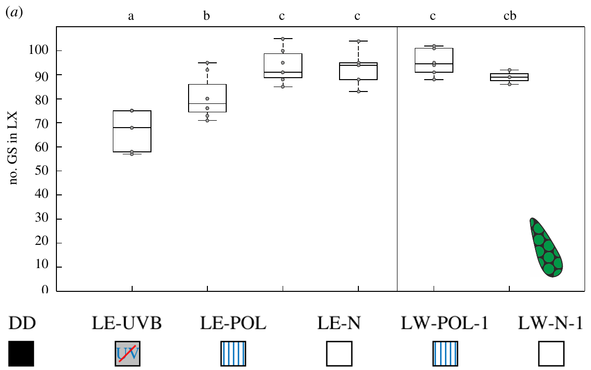
Light exposure changes the lateral-complex pathway
Light exposure and active learning walks are separable experiences. Grob and colleagues tested dark controls alongside ants exposed to natural skylight, ultraviolet-filtered skylight or a fixed polarization pattern. Additional groups performed learning walks. The dark control sets the baseline for every light condition. Each group therefore isolates one kind of experience.
After three days, lateral-complex giant-synapse counts rose under suitable full-spectrum light exposure even without learning walks. The design distinguishes the influence of light from the influence of learning walks. Central-complex volume followed a different pattern. The response depended on full-spectrum light rather than on learning walks alone. The lateral-complex change is therefore a light effect.
The dissociation shows that the two visual pathways require different kinds of experience. The lateral-complex synaptic count responds to ultraviolet-containing light alone. The endpoint of that comparison was synaptic structure rather than homing accuracy. Removing ultraviolet light lowered that response. The two pathways therefore respond to different features of experience.
Grob et al. (2022), Fig. 2(a). Lateral-complex synaptic counts across light conditions.
Grob et al. (2022), Fig. 1(c). Central complex, lateral complex and mushroom-body synaptic anatomy.
Grob et al. (2022)
26
Notes:
• **Light exposure** and active learning walks are separable experimental experiences. Grob and colleagues compared dark controls with ants exposed to natural skylight, ultraviolet-filtered skylight or a fixed polarization pattern, with additional groups allowed to perform learning walks.
• After three days, lateral-complex giant-synapse counts increased under suitable full-spectrum light exposure even without learning walks. Removing ultraviolet light reduced this response. Central-complex volume did not exhibit the same simple light-exposure dependence as the lateral-complex synaptic count.
• The dissociation supports different experience requirements in the two visual pathways. It does not identify ultraviolet phototransduction channels or prove that additional lateral-complex synapses are sufficient for accurate homing; the measured endpoint was synaptic structure rather than navigational performance.
References:
Grob R, Holland Cunz O, Grübel K, Pfeiffer K, Rössler W, Fleischmann PN (2022). Rotation of skylight polarization during learning walks is necessary to trigger neuronal plasticity in Cataglyphis ants. Proceedings of the Royal Society B 289:20212499. https://doi.org/10.1098/rspb.2021.2499
Figure: Grob et al. (2022), Fig. 2(a). Lateral-complex synaptic counts across light conditions.
Figure source: https://doi.org/10.1098/rspb.2021.2499
Figure: Grob et al. (2022), Fig. 1(c). Central complex, lateral complex and mushroom-body synaptic anatomy.
Figure source: https://doi.org/10.1098/rspb.2021.2499

Slide 35
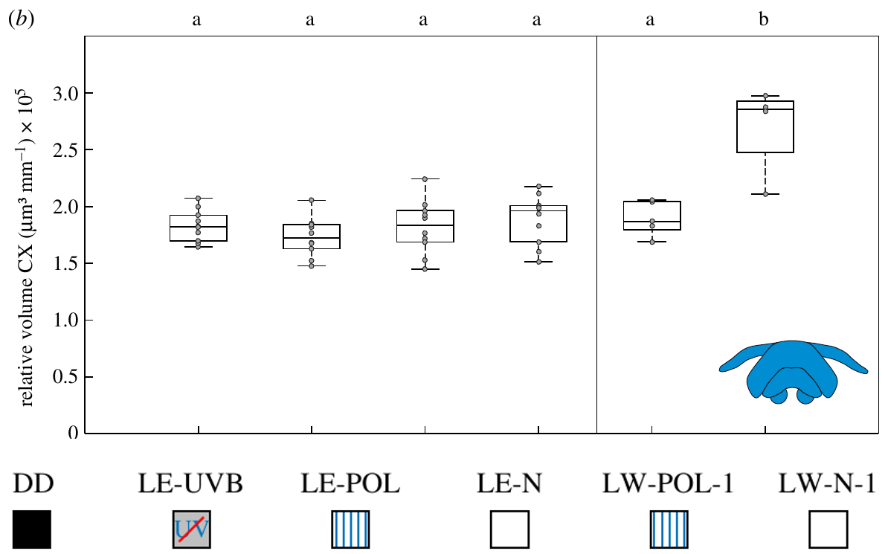
Central-complex growth requires more than light alone
Structural plasticity is an experience-associated change in neuronal anatomy, such as neuropil volume or synaptic organization. It is distinct from an acute firing-rate response to a sensory stimulus. Such growth accumulates over days of experience. Neither is an acute firing response. Growth and reorganization both count as structural change. The change is therefore slow relative to an acute response.
After three days, natural learning walks increased central-complex volume relative to dark controls. Passive light exposure and learning walks under a stationary polarization filter failed to produce the same increase. Brain volumes were corrected for body size. The volumes are therefore comparable between animals. The dark controls set the reference for each measured volume.
The volume change could arise from extra synapses, expanded neurites or other tissue components. Causal tests of path integration would address whether this growth is required for the behavior. Only that kind of test would link the growth to behavior. The growth therefore needs a direct test of its functional role.
Grob et al. (2022), Fig. 2(b). Central-complex volumes after light exposure or learning walks.
Grob et al. (2022), Fig. 1(c). Central complex, lateral complex and mushroom-body synaptic anatomy.
Grob et al. (2022)
27
Notes:
• **Structural plasticity** is an experience-associated change in neuronal anatomy, such as neuropil volume or synaptic organization. It must be distinguished from an acute firing-rate response to a sensory stimulus.
• After three days, natural learning walks increased the size-corrected central-complex volume relative to dark controls. Passive light exposure and learning walks under a stationary polarization filter did not produce the same increase. Brain volumes were corrected for body size rather than compared solely as raw tissue amounts.
• The result links active experience with changing celestial information to central-complex structure. It does not establish whether volume changes arise from extra synapses, expanded neurites or other tissue components, nor whether the observed growth is causally required for path integration.
References:
Grob R, Holland Cunz O, Grübel K, Pfeiffer K, Rössler W, Fleischmann PN (2022). Rotation of skylight polarization during learning walks is necessary to trigger neuronal plasticity in Cataglyphis ants. Proceedings of the Royal Society B 289:20212499. https://doi.org/10.1098/rspb.2021.2499
Figure: Grob et al. (2022), Fig. 2(b). Central-complex volumes after light exposure or learning walks.
Figure source: https://doi.org/10.1098/rspb.2021.2499
Figure: Grob et al. (2022), Fig. 1(c). Central complex, lateral complex and mushroom-body synaptic anatomy.
Figure source: https://doi.org/10.1098/rspb.2021.2499

Slide 36
Learning-walk setup defines the treatment groups
A table installed 30 cm above the nest entrance held the polarization filter over a 60 × 60 cm learning-walk area. Novices tested around natural nests in Greece experienced their defined skylight condition over three days. Novices performed learning walks around the nest.
A time-compensated compass has to follow the sun's position, which changes through the day. Initial learning can establish the link between those celestial changes and stable surroundings. Each treatment set how often the polarization direction changed.
Across the learning-walk schedules, volume changed in the central complex and in the mushroom-body collar, while giant-synapse counts stayed broadly similar. The continuous rotation condition changed filter orientation at 15° per hour. The natural skylight condition was one of those schedules.
Grob et al. (2022), Fig. 2(b). Central-complex volumes after light exposure or learning walks.
Grob et al. (2022), Fig. 1(c). Central complex, lateral complex and mushroom-body synaptic anatomy.
Grob et al. (2022)
27a
Notes:
• Learning-walk setup defines the treatment groups.
• Explanation 1.
– A table installed 30 cm above the nest entrance held the polarization filter over a 60 × 60 cm learning-walk area
– Novices tested around natural nests in Greece experienced their defined skylight condition over three days. Novices performed learning walks around the nest.
• Explanation 2.
– A time-compensated compass has to follow the sun's position, which changes through the day
– Initial learning can establish the link between those celestial changes and stable surroundings. Each treatment set how often the polarization direction changed.
• Explanation 3.
– Across the learning-walk schedules, volume changed in the central complex and in the mushroom-body collar, while giant-synapse counts stayed broadly similar
– The continuous rotation condition changed filter orientation at 15° per hour. The natural skylight condition was one of those schedules.
• Source.
– The figure and the measurements come from Grob et al. (2022).
– Each statement is tied to the recordings or observations of that study.
References:
Grob R, Holland Cunz O, Grübel K, Pfeiffer K, Rössler W, Fleischmann PN (2022). Rotation of skylight polarization during learning walks is necessary to trigger neuronal plasticity in Cataglyphis ants. Proceedings of the Royal Society B 289:20212499. https://doi.org/10.1098/rspb.2021.2499

Slide 37
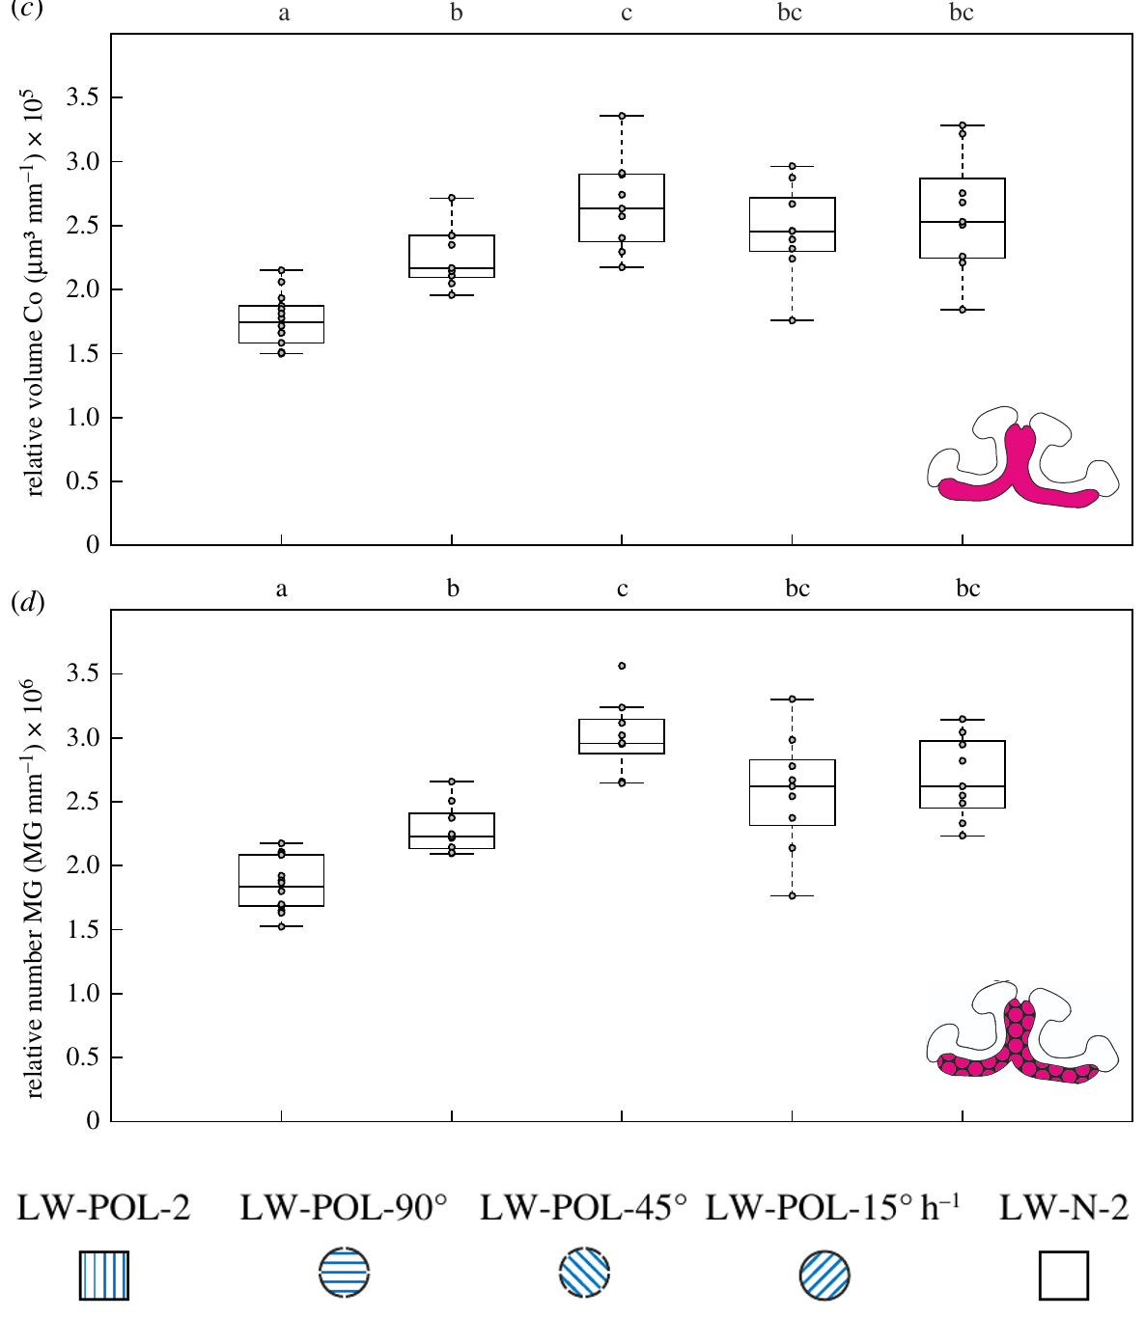
Rotation during learning changes mushroom-body structure
The mushroom-body collar is a visual input region of the mushroom-body calyx. Its microglomeruli receive visual information and provide a measurable synaptic endpoint for changes that accompany acquisition of outdoor experience. The collar therefore records visual experience as a change in synapse numbers. The synapses respond to the changing sky, not to light alone.
This result follows from the schedule design. A stationary pattern failed to elicit the growth associated with changing polarization. Each schedule of changing polarization increased collar volume and microglomerular number. The three changing schedules and the stationary pattern therefore form a direct comparison. Each schedule is therefore judged against the stationary pattern.
Change in the compass-related environment is the driving variable, since a stationary pattern produced no growth even though polarized light was present. The growth is measured as an anatomical outcome of the schedule. The growth follows the changing compass reference rather than polarized light by itself. Polarized light alone therefore did not account for the collar growth.
Grob et al. (2022), Fig. 1(c). Central complex, lateral complex and mushroom-body synaptic anatomy.
Grob et al. (2022), Fig. 3(c–d). Mushroom-body volume and microglomeruli under polarization rotation.
Grob et al. (2022)
28
Notes:
• The **mushroom-body collar** is a visual input region of the mushroom-body calyx. Its microglomeruli receive visual information and provide a measurable synaptic endpoint for changes accompanying the acquisition of outdoor experience.
• Grob and colleagues allowed three days of learning walks under different polarization schedules. A stationary pattern failed to elicit the growth associated with changing polarization. A single 90° daily turn, hourly 45° turns and continuous 15°-per-hour rotation supported increases in collar volume and microglomerular number.
• The comparison separates a changing compass-related environment from polarized illumination alone. It does not prove that these mushroom-body synapses encode the complete solar ephemeris, and it does not equate structural growth with a measured increase in synaptic current or behavioral accuracy.
References:
Grob R, Holland Cunz O, Grübel K, Pfeiffer K, Rössler W, Fleischmann PN (2022). Rotation of skylight polarization during learning walks is necessary to trigger neuronal plasticity in Cataglyphis ants. Proceedings of the Royal Society B 289:20212499. https://doi.org/10.1098/rspb.2021.2499
Figure: Grob et al. (2022), Fig. 3(c–d). Mushroom-body volume and microglomeruli under polarization rotation.
Figure source: https://doi.org/10.1098/rspb.2021.2499
Figure: Grob et al. (2022), Fig. 1(c). Central complex, lateral complex and mushroom-body synaptic anatomy.
Figure source: https://doi.org/10.1098/rspb.2021.2499

Slide 38
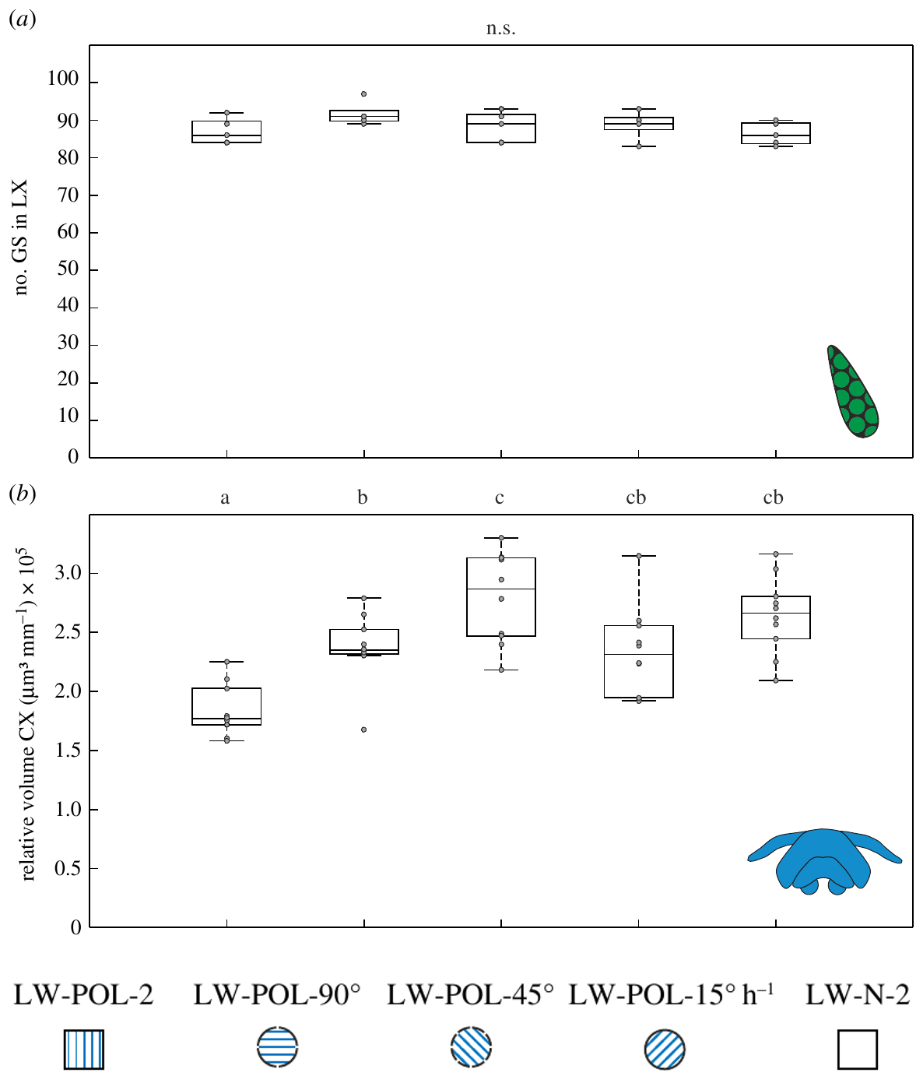
Rotation affects higher centres more than giant synapses
A common sensory manipulation can affect brain regions differently. The lateral complex lies along the sky-compass pathway, while the central complex and mushroom-body collar provide distinct higher-order measures of change. Each region therefore records the same experience in its own way. The lateral complex is the exception among these regions.
Across the three-day learning-walk experiment, the rotation schedules altered central-complex volume and mushroom-body measures. Giant-synapse counts in the lateral complex stayed broadly similar. The stationary condition provides the baseline for each schedule. Rotation therefore affected higher centers more strongly than giant synapses. Each schedule therefore reports its own effect across all schedules tested.
Giant-synapse numbers were similar across schedules, so the lateral complex responded less to rotation than the higher centers. Release, strength and firing are separate physiological measures, while counts describe structure. Giant synapses and collar growth therefore diverge under the same schedules. Those measures need recordings that counts never give here.
Grob et al. (2022), Fig. 1(c). Central complex, lateral complex and mushroom-body synaptic anatomy.
Grob et al. (2022), Fig. 3(a–b). Giant synapses and central-complex volume under polarization rotation.
Grob et al. (2022)
29
Notes:
• A common sensory manipulation can affect different brain regions differently. The lateral complex lies along the sky-compass pathway, whereas the central complex and mushroom-body collar provide distinct higher-order measures of experience-associated change.
• Across the three-day learning-walk experiment, the different polarization-rotation schedules altered central-complex volume and mushroom-body measures, but giant-synapse counts in the lateral complex remained broadly similar. The continuous rotation condition changed filter orientation at 15° per hour.
• The dissociation limits a claim of uniform growth throughout the visual system. Similar giant-synapse numbers do not establish identical activity in that pathway; transmitter release, synaptic strength and firing patterns were not measured by counting anatomical complexes.
References:
Grob R, Holland Cunz O, Grübel K, Pfeiffer K, Rössler W, Fleischmann PN (2022). Rotation of skylight polarization during learning walks is necessary to trigger neuronal plasticity in Cataglyphis ants. Proceedings of the Royal Society B 289:20212499. https://doi.org/10.1098/rspb.2021.2499
Figure: Grob et al. (2022), Fig. 3(a–b). Giant synapses and central-complex volume under polarization rotation.
Figure source: https://doi.org/10.1098/rspb.2021.2499
Figure: Grob et al. (2022), Fig. 1(c). Central complex, lateral complex and mushroom-body synaptic anatomy.
Figure source: https://doi.org/10.1098/rspb.2021.2499

Slide 39
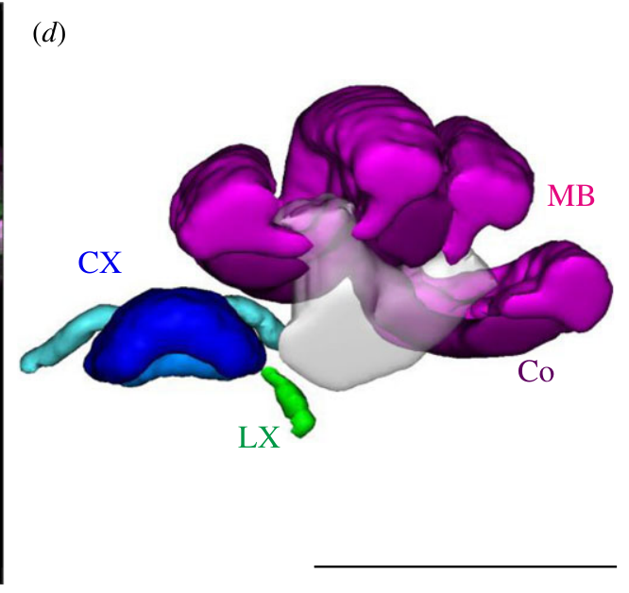
Transmitter assignments constrain proposed circuit roles
The pathways differ in transmitter identity, which may contribute to their distinct plasticity. These classifications describe signaling identity, while the postsynaptic effect also depends on receptor type and cellular conditions. Receptors determine what the target does. The postsynaptic effect therefore depends on more than the transmitter. Transmitter identity is one part of the outcome.
Grob and colleagues measured structural endpoints in these pathways rather than pharmacologically isolating transmitter action. A transmitter identity names the chemical signal, while receptors determine what the target does. The authors offer the resulting differences as a hypothesis rather than a measured mechanism. Receptor identity at each synapse sets the postsynaptic result.
The distinction between identity and effect is central to this open question. Which receptor subtype, ion channel or intracellular cascade drives the volume and synaptic changes is a question for pharmacological work. Such tests would target specific receptor subtypes directly. The transmitter identities themselves were not manipulated in this study.
Grob et al. (2022), Fig. 1(d). Published three-dimensional reconstruction of visual integration centres.
Grob et al. (2022)
30
Notes:
• **GABAergic** neurons use gamma-aminobutyric acid as a transmitter; **cholinergic** neurons use acetylcholine. These transmitter classifications describe signaling identity, while the postsynaptic effect also depends on receptor type and cellular conditions.
• Grob and colleagues discuss evidence that most tangential neurons projecting from the lateral complex toward the central complex are GABAergic, whereas visual projection neurons supplying mushroom bodies are presumably cholinergic. Their three-day experience experiment measured structural endpoints in these pathways rather than pharmacologically isolating transmitter action.
• The different transmitter identities may contribute to different plasticity patterns, but that explanation was proposed rather than tested here. The study does not establish which GABA or acetylcholine receptor subtype, ion channel or intracellular cascade causes the observed volume and synaptic changes.
References:
Grob R, Holland Cunz O, Grübel K, Pfeiffer K, Rössler W, Fleischmann PN (2022). Rotation of skylight polarization during learning walks is necessary to trigger neuronal plasticity in Cataglyphis ants. Proceedings of the Royal Society B 289:20212499. https://doi.org/10.1098/rspb.2021.2499
Figure: Grob et al. (2022), Fig. 1(d). Published three-dimensional reconstruction of visual integration centres.
Figure source: https://doi.org/10.1098/rspb.2021.2499

Slide 40
Rotation schedules shape collar and lateral responses
Each of the three rotating schedules raised collar volume and the microglomerular count. A stationary pattern produced no such growth, and polarized light alone did not produce that growth either. The stationary pattern was the reference condition for the rotating schedules.
Lateral-complex giant synapses changed little across those schedules. Continuous rotation advanced the filter orientation by 15° per hour, a slower step than the hourly 45° turns, and the schedules differed in how fast the pattern rotated over three days.
Learning walks take the ant on short trips around the nest as it moves from indoor work to outdoor foraging. The sky-compass pathway runs through the lateral complex, one of the visual integration centers. Mushroom-body volume responded to the same schedules.
Grob et al. (2022), Fig. 1(d). Published three-dimensional reconstruction of visual integration centres.
Grob et al. (2022)
30a
Notes:
• Rotation schedules shape collar and lateral responses.
• Explanation 1.
– Each of the three rotating schedules raised collar volume and the microglomerular count
– A stationary pattern produced no such growth, and polarized light alone did not produce that growth either. The stationary pattern was the reference condition for the rotating schedules.
• Explanation 2.
– Lateral-complex giant synapses changed little across those schedules
– Continuous rotation advanced the filter orientation by 15° per hour, a slower step than the hourly 45° turns, and the schedules differed in how fast the pattern rotated over three days.
• Explanation 3.
– Learning walks take the ant on short trips around the nest as it moves from indoor work to outdoor foraging
– The sky-compass pathway runs through the lateral complex, one of the visual integration centers. Mushroom-body volume responded to the same schedules.
• Source.
– The figure and the measurements come from Grob et al. (2022).
– Each statement is tied to the recordings or observations of that study.
References:
Grob R, Holland Cunz O, Grübel K, Pfeiffer K, Rössler W, Fleischmann PN (2022). Rotation of skylight polarization during learning walks is necessary to trigger neuronal plasticity in Cataglyphis ants. Proceedings of the Royal Society B 289:20212499. https://doi.org/10.1098/rspb.2021.2499

Slide 41
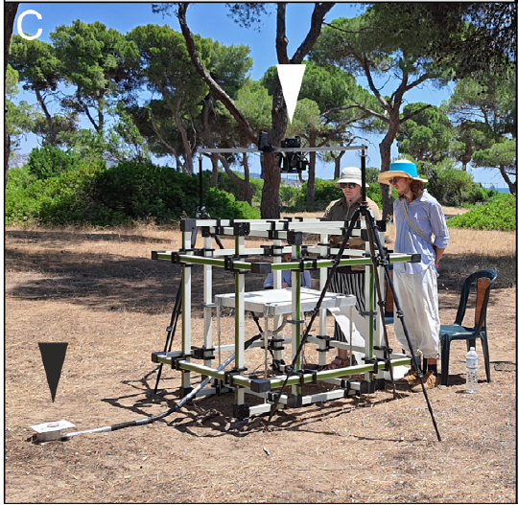
Magnetic coils isolate the reference used during learning
The geomagnetic field is Earth's magnetic field, which can supply a directional reference independent of the sun's daily movement. A Helmholtz coil system generates controlled magnetic fields in an experimental volume. A controlled field allows the investigators to vary the magnetic reference independently of the sky. The field's magnitude and direction can be set independently.
The platform was 60 × 60 cm and was connected directly to the nest. Novices performed learning walks over three consecutive days. The natural field at the site was known, so manipulated conditions could be set relative to it. The natural total field at the site was about 46.1 µT.
The same dark interior-worker controls served in every magnetic condition tested here. Several magnetic conditions were set against dark interior-worker controls to assess experience-associated brain changes. Nest-directed pirouettes served as the orientation measure. The natural panorama and celestial cues remained available during these manipulations. The design isolates the magnetic component.
Grob et al. (2024), Fig. 1(C). Helmholtz coils and the learning-walk platform.
Grob et al. (2024)
31
Notes:
• The **geomagnetic field** is Earth’s magnetic field, which can provide a directional reference independent of the sun’s daily movement. A **Helmholtz coil system** generates controlled magnetic fields in an experimental volume.
• Grob and colleagues installed a three-dimensional coil system around a 60 × 60 cm platform connected to a Cataglyphis nodus nest. Novices performed learning walks over three consecutive days. At the site, the natural total field was about 46.1 µT, with a horizontal component of 26.6 µT.
• The preparation manipulated magnetic information while retaining the natural panorama and celestial environment. Comparing several magnetic conditions with dark interior-worker controls allowed assessment of experience-associated brain changes, but did not directly identify a magnetic receptor or selectively stimulate a known magnetosensory neuron.
References:
Grob R, Müller VL, Grübel K, Rössler W, Fleischmann PN (2024). Importance of magnetic information for neuronal plasticity in desert ants. Proceedings of the National Academy of Sciences 121(8):e2320764121. https://doi.org/10.1073/pnas.2320764121
Figure: Grob et al. (2024), Fig. 1(C). Helmholtz coils and the learning-walk platform.
Figure source: https://doi.org/10.1073/pnas.2320764121

Slide 42
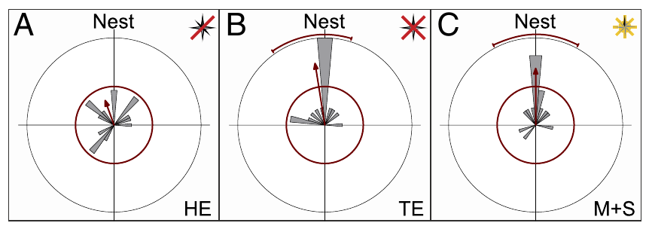
Removing horizontal magnetic information disrupts gazes
A pirouette is a rotation around the ant's body axis during a learning walk. Under natural conditions, the longest pauses in these rotations point toward the nest, giving a measurable orientation behavior near the nest entrance. The pauses therefore provide a direction-specific readout during each walk. Longest pauses were analyzed as directions relative to the nest.
In the horizontal-elimination condition, the coils canceled the horizontal field component while keeping a downward vertical field. The longest stopping directions lost their clustering toward the nest in the published angular distributions. The horizontal component was therefore required for this clustering. The vertical component measured about 37.5 µT in this condition.
The result supports a role for horizontal magnetic information in nest-directed behavior under this condition. A downward vertical field remains a directional cue, which differs fundamentally from removing magnetic information entirely. Vertical information therefore has consequences that complete removal lacks. Horizontal information therefore supports the nest-directed signal in this design.
Grob et al. (2024), Fig. 2(A–C). Nest-directed gazes under three magnetic manipulations.
Grob et al. (2024)
32
Notes:
• A **pirouette** is a rotation around the ant’s body axis during a learning walk. Under natural conditions, the longest pauses in these rotations are directed toward the nest, providing a measurable orientation behavior near the nest entrance.
• In the horizontal-elimination condition, the coils cancelled the horizontal field component while retaining a downward vertical field of about 37.5 µT. The longest stopping directions no longer clustered toward the nest in the published angular distributions, which used 10° bins.
• The result supports a role for horizontal magnetic information in the novices’ nest-directed behavior under this condition. It does not prove that every other compass cue is unavailable, and the remaining vertical field differs fundamentally from removing magnetic information entirely.
References:
Grob R, Müller VL, Grübel K, Rössler W, Fleischmann PN (2024). Importance of magnetic information for neuronal plasticity in desert ants. Proceedings of the National Academy of Sciences 121(8):e2320764121. https://doi.org/10.1073/pnas.2320764121
Figure: Grob et al. (2024), Fig. 2(A–C). Nest-directed gazes under three magnetic manipulations.
Figure source: https://doi.org/10.1073/pnas.2320764121

Slide 43
Complete field elimination permits a different outcome
Complete magnetic-field elimination is a distinct cue manipulation from retaining a vertical field. Grob and colleagues canceled the horizontal and vertical components, so the magnetic environment contained no directional cue pointing downward. Total elimination therefore removes the vertical cue as well. Each component of the field was canceled separately in the experiment.
Under total elimination, ants still directed their longest pirouette pauses toward the nest. This contrasted with the loss of nest-directed gazes seen when the horizontal component alone had been eliminated. This contrast is central to the authors' interpretation. This comparison isolates the horizontal component. The contrast reveals the role of the horizontal component.
Panoramic information is a candidate substitute cue when magnetic information is absent altogether. Identifying the switching mechanism would reveal which cue takes over. That candidate is one of several interpretations. Panoramic information is one candidate for that substitute. The contrast points to a switch in cue use rather than a loss of direction.
Grob et al. (2024), Fig. 2(A–C). Nest-directed gazes under three magnetic manipulations.
Grob et al. (2024)
33
Notes:
• Complete magnetic-field elimination is a distinct cue manipulation from retaining a vertical field. Grob and colleagues cancelled both the horizontal and vertical components rather than leaving a directional magnetic cue pointing downward.
• Under total elimination, the residual field was about 0.1 µT. Ants nevertheless directed their longest pirouette pauses toward the nest. This differed from the loss of nest-directed gazes when only the horizontal component had been eliminated.
• The authors interpreted the contrast as possible recruitment of a backup compass when magnetic information was absent altogether. Panoramic information is a candidate, but the experiment did not independently remove it, so the specific substitute cue and the switching mechanism remain unresolved.
References:
Grob R, Müller VL, Grübel K, Rössler W, Fleischmann PN (2024). Importance of magnetic information for neuronal plasticity in desert ants. Proceedings of the National Academy of Sciences 121(8):e2320764121. https://doi.org/10.1073/pnas.2320764121
Figure: Grob et al. (2024), Fig. 2(A–C). Nest-directed gazes under three magnetic manipulations.
Figure source: https://doi.org/10.1073/pnas.2320764121

Slide 44
Natural field components set the magnetic conditions
The coil system was three-dimensional. The natural field measured 46.1 µT in total, and 26.6 µT of that was horizontal. Helmholtz coils set the horizontal and vertical components separately in each condition. The coils set the field in a volume around the learning platform.
With horizontal elimination, the downward vertical field measured about 37.5 µT. The published angular distributions of nest-directed gazes were binned at 10°. The coils surrounded a 60 × 60 cm platform joined to the nest, and novices learned on it for three days. The retained field pointed downward, not horizontally.
Central-complex volume rose in the natural field and in several elimination or disarray conditions over three days. Nest-directed gazes were scored from the longest pirouette pauses in each walk. Under natural conditions, those pauses point toward the nest. Those pauses were scored within each ant's own walk.
Grob et al. (2024), Fig. 2(A–C). Nest-directed gazes under three magnetic manipulations.
Grob et al. (2024)
33a
Notes:
• Natural field components set the magnetic conditions.
• Explanation 1.
– The coil system was three-dimensional
– The natural field measured 46.1 µT in total, and 26.6 µT of that was horizontal. Helmholtz coils set the horizontal and vertical components separately in each condition. The coils set the field in a volume around the learning platform.
• Explanation 2.
– With horizontal elimination, the downward vertical field measured about 37.5 µT
– The published angular distributions of nest-directed gazes were binned at 10°. The coils surrounded a 60 × 60 cm platform joined to the nest, and novices learned on it for three days. The retained field pointed downward, not horizontally.
• Explanation 3.
– Central-complex volume rose in the natural field and in several elimination or disarray conditions over three days
– Nest-directed gazes were scored from the longest pirouette pauses in each walk. Under natural conditions, those pauses point toward the nest. Those pauses were scored within each ant's own walk.
• Source.
– The figure and the measurements come from Grob et al. (2024).
– Each statement is tied to the recordings or observations of that study.
References:
Grob R, Müller VL, Grübel K, Rössler W, Fleischmann PN (2024). Importance of magnetic information for neuronal plasticity in desert ants. Proceedings of the National Academy of Sciences 121(8):e2320764121. https://doi.org/10.1073/pnas.2320764121

Slide 45
A rotating magnetic vector can still guide look-backs
A magnetic cue can serve as a usable short-term directional reference even when its direction differs from natural magnetic north. What matters is whether the direction stays stable during each individual learning walk. Individual walks lasted seconds to minutes, so the reference only needed to hold briefly. The reference needs to be stable only within each walk.
In the magnetic-plus-solar condition, the horizontal vector was adjusted to follow the sun's azimuth over the day. Ants kept directing their longest stops toward the nest despite the vector's changing geographical alignment. The solar azimuth therefore sets the reference direction. The horizontal vector was updated every 10 seconds. Each update kept the vector aligned with the sun's current azimuth.
Preserved look-backs show that an individual short excursion can use a reference that changes over the day. The manipulation made magnetic and celestial directions covary over the day, which removed their natural changing angular relationship. Look-backs therefore reflect the reference of the moment. Calibration was a separate measure in this experiment.
Grob et al. (2024), Fig. 2(A–C). Nest-directed gazes under three magnetic manipulations.
Grob et al. (2024)
34
Notes:
• A magnetic cue need not always point toward natural magnetic north to provide a usable short-term directional reference. The relevant comparison is whether its direction remains sufficiently stable during each individual learning walk.
• In the magnetic-plus-solar condition, the horizontal vector was adjusted every 10 seconds to follow the sun’s azimuth over the day. Individual walks lasted seconds to minutes, and ants retained nest-directed longest stops despite the vector’s changing geographical alignment.
• The preservation of look-back behavior does not establish normal long-term calibration. The manipulation makes magnetic and celestial directions covary over the day, removing their natural changing angular relationship even while leaving a useful reference for an individual short excursion.
References:
Grob R, Müller VL, Grübel K, Rössler W, Fleischmann PN (2024). Importance of magnetic information for neuronal plasticity in desert ants. Proceedings of the National Academy of Sciences 121(8):e2320764121. https://doi.org/10.1073/pnas.2320764121
Figure: Grob et al. (2024), Fig. 2(A–C). Nest-directed gazes under three magnetic manipulations.
Figure source: https://doi.org/10.1073/pnas.2320764121

Slide 46
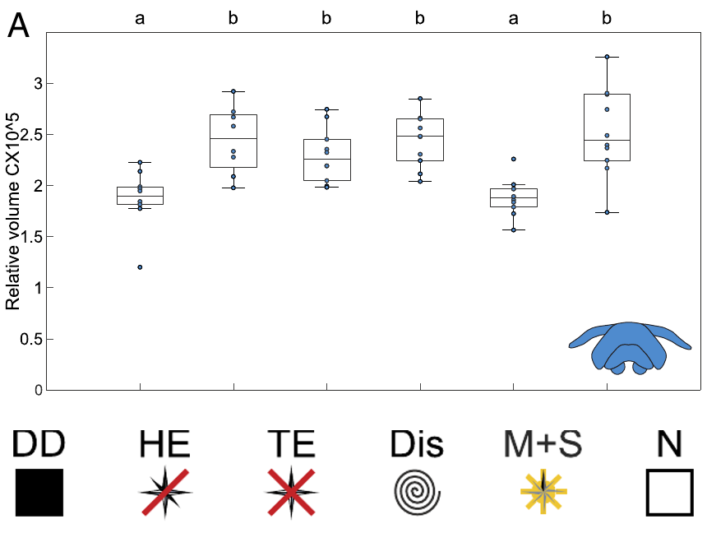
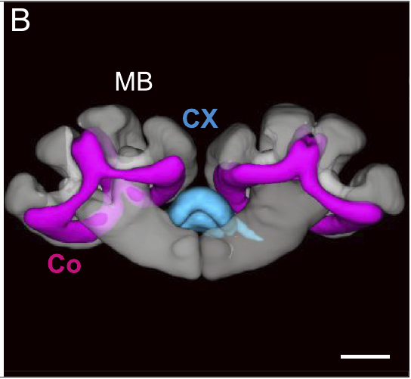
Magnetic treatments dissociate gaze and brain growth
The two endpoints measure different timescales of the ant's experience. A successful look-back measures orientation during a walk, while central-complex growth reflects the learning that accumulates across days. The two endpoints therefore answer different questions about the animal. Look-backs and growth are therefore complementary readouts. Each measure captures a different timescale of the ant's experience.
After three days, central-complex volume increased under natural magnetic conditions and under several elimination or disarray conditions. When the magnetic vector followed the solar azimuth, central-complex growth was absent relative to dark controls. Dark controls set the baseline for that growth. Volume was corrected for body size in each animal.
Central-complex growth followed the full three-day learning period in this study. It implicates the changing relation between compass cues in central-complex growth. Volume was the endpoint in each comparison. A causal test would need a manipulation that removes the growth. Growth and look-backs therefore measure separate features of the ant's experience.
Grob et al. (2024), Fig. 4(A). Central-complex volume under magnetic treatments.
Grob et al. (2024), Fig. 3(B). Central complex and mushroom-body collar reconstruction.
Grob et al. (2024)
35
Notes:
• Accurate nest-directed gazes and structural brain change are different experimental endpoints. Recording a successful look-back does not guarantee that all compass-calibration and visual-memory processes associated with the learning period occur normally.
• After three days, central-complex volume increased under natural magnetic conditions and under several elimination or disarray conditions. When the magnetic vector followed solar azimuth, central-complex growth did not occur relative to dark controls, despite preserved nest-directed look-backs.
• The result dissociates an immediate orientation behavior from an experience-associated anatomical outcome. It supports a role for the changing relation between compass cues, but does not demonstrate that absent volume growth causes a later navigation deficit; that causal behavioral test was not performed.
References:
Grob R, Müller VL, Grübel K, Rössler W, Fleischmann PN (2024). Importance of magnetic information for neuronal plasticity in desert ants. Proceedings of the National Academy of Sciences 121(8):e2320764121. https://doi.org/10.1073/pnas.2320764121
Figure: Grob et al. (2024), Fig. 4(A). Central-complex volume under magnetic treatments.
Figure source: https://doi.org/10.1073/pnas.2320764121
Figure: Grob et al. (2024), Fig. 3(B). Central complex and mushroom-body collar reconstruction.
Figure source: https://doi.org/10.1073/pnas.2320764121

Slide 47
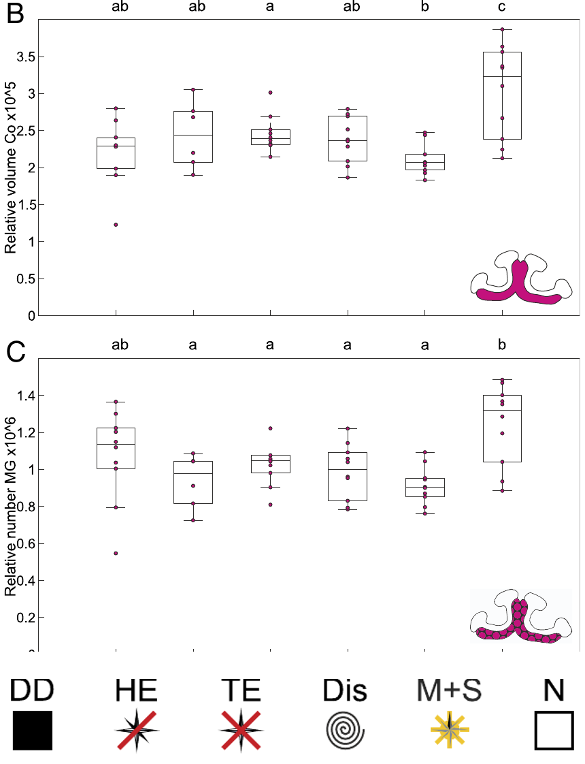
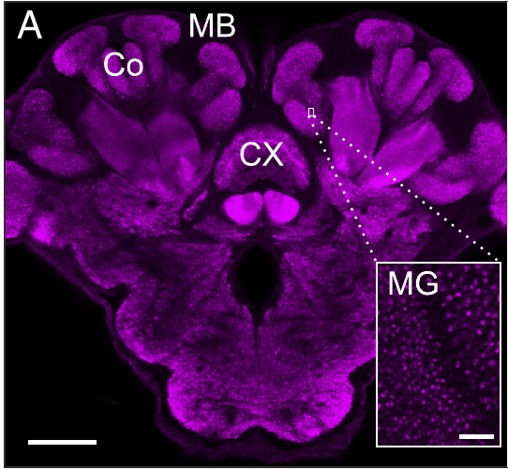
Magnetic cues affect mushroom-body plasticity
Visual memories acquired near the nest may require information that specifies which direction the ant is facing. The mushroom-body collar provides a visual input region in which synaptic structure can be compared after controlled learning experience. Its microglomeruli receive visual information in this region. The collar's synapses therefore register the visual information the ant gathers.
The collar's synapses are therefore positioned to register visual information that the ant gathers. Both measures increased under the natural field, while the altered magnetic conditions produced no equivalent increases. The size correction was applied to each animal before the groups were measured. Microglomerular number and collar volume were the two outcome measures.
The association supports a role for appropriate magnetic information in experience-dependent visual circuitry. Magnetic information of the correct kind thus appears to take part in how the visual input region develops. The development of this region depends on the magnetic information present during learning. Such plasticity is tied to the learning context.
Grob et al. (2024), Fig. 3(A). Synapsin-labelled brain and mushroom-body microglomeruli.
Grob et al. (2024), Fig. 4(B–C). Mushroom-body volume and synaptic complexes under magnetic treatments.
Grob et al. (2024)
36
Notes:
• Visual memories acquired near the nest may require information specifying which direction the ant is facing. The mushroom-body collar provides a visual input region in which synaptic structure can be compared after controlled learning experience.
• Grob and colleagues measured size-corrected collar volume and microglomerular number after three days of learning walks. These measures increased under the natural field, while the tested altered magnetic conditions did not produce the same increases. The effect differed from central-complex responses to complete field removal.
• The association supports a role for appropriate magnetic information in experience-dependent visual circuitry. It does not identify an engram for a particular view, prove that microglomerular growth stores the nest panorama, or establish which molecular signal controls consolidation.
References:
Grob R, Müller VL, Grübel K, Rössler W, Fleischmann PN (2024). Importance of magnetic information for neuronal plasticity in desert ants. Proceedings of the National Academy of Sciences 121(8):e2320764121. https://doi.org/10.1073/pnas.2320764121
Figure: Grob et al. (2024), Fig. 4(B–C). Mushroom-body volume and synaptic complexes under magnetic treatments.
Figure source: https://doi.org/10.1073/pnas.2320764121
Figure: Grob et al. (2024), Fig. 3(A). Synapsin-labelled brain and mushroom-body microglomeruli.
Figure source: https://doi.org/10.1073/pnas.2320764121

Slide 48
Magnetic conditions set collar and microglomerular growth
The magnetic-plus-solar condition adjusted the horizontal vector every 10 seconds to follow the sun's azimuth across the day. Individual learning walks lasted seconds to minutes, and the reference only had to hold during each walk. During each walk, the sun's azimuth set the direction of the vector. The same magnetic-plus-solar condition kept the look-back behavior intact.
Under total elimination, the residual field was about 0.1 µT, far below the natural value. Complete removal differs from a remaining downward vertical field. The natural field was measured at the same site as the coil platform. The altered conditions were set relative to the natural field measured at this site.
The coils controlled the horizontal and vertical field components separately, while the natural panorama stayed in view. Both collar volume and microglomerular number were corrected for body size. Nest-directed pirouette pauses were the orientation measure in each condition. These two endpoints were measured after the same three-day learning period. Both measures were taken from the same brains.
Grob et al. (2024), Fig. 3(A). Synapsin-labelled brain and mushroom-body microglomeruli.
Grob et al. (2024), Fig. 4(B–C). Mushroom-body volume and synaptic complexes under magnetic treatments.
Grob et al. (2024)
36a
Notes:
• Magnetic conditions set collar and microglomerular growth.
• Explanation 1.
– The magnetic-plus-solar condition adjusted the horizontal vector every 10 seconds to follow the sun's azimuth across the day
– Individual learning walks lasted seconds to minutes, and the reference only had to hold during each walk. During each walk, the sun's azimuth set the direction of the vector. The same magnetic-plus-solar condition kept the look-back behavior intact.
• Explanation 2.
– Under total elimination, the residual field was about 0.1 µT, far below the natural value
– Complete removal differs from a remaining downward vertical field. The natural field was measured at the same site as the coil platform. The altered conditions were set relative to the natural field measured at this site.
• Explanation 3.
– The coils controlled the horizontal and vertical field components separately, while the natural panorama stayed in view
– Both collar volume and microglomerular number were corrected for body size. Nest-directed pirouette pauses were the orientation measure in each condition. These two endpoints were measured after the same three-day learning period. Both measures were taken from the same brains.
• Source.
– The figure and the measurements come from Grob et al. (2024).
– Each statement is tied to the recordings or observations of that study.
References:
Grob R, Müller VL, Grübel K, Rössler W, Fleischmann PN (2024). Importance of magnetic information for neuronal plasticity in desert ants. Proceedings of the National Academy of Sciences 121(8):e2320764121. https://doi.org/10.1073/pnas.2320764121

Slide 49
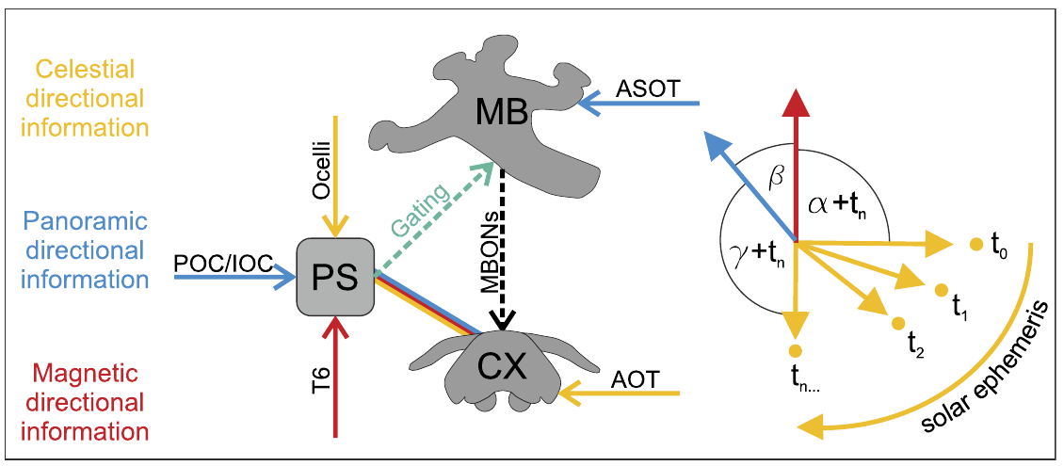
A stable reference may calibrate the moving sky compass
Compass calibration establishes the relationship between a sensory directional cue and an internal heading reference. The sun and polarization pattern change over the day, whereas natural magnetic direction and a fixed panorama are comparatively stable external references. A calibration of this kind links a moving cue to fixed external references.
The three-day magnetic experiment separated natural-field exposure from a vector that rotated with the sun. The proposed circuit hypothesis suggests convergence of magnetic, panoramic and celestial information in the posterior slope. The posterior slope is a multisensory brain region linked to the central complex. The model predicts this convergence from comparative connectivity.
Ion channels and receptors would need to be identified before the mechanism could be confirmed. The antennal Johnston's organ is a candidate contributor to magnetoreception. No magnetic receptor molecule or ion channel has yet been identified. Ion channels and receptors would need to be identified before the mechanism is confirmed.
Grob et al. (2024), Fig. 5. Published hypothesis for integrating magnetic and celestial information.
Grob et al. (2024)
37
Notes:
• **Compass calibration** establishes the relationship between a sensory directional cue and an internal heading reference. The sun and polarization pattern change over the day, whereas natural magnetic direction and a fixed panorama provide comparatively stable external references.
• The three-day magnetic experiment dissociated natural-field exposure from a vector that rotated with the sun. The published circuit hypothesis proposes convergence of magnetic, panoramic and celestial information in the **posterior slope**, a multisensory brain region linked to the central complex.
• The posterior-slope mechanism is a proposed anatomical account supported by comparative connectivity, not a direct recording of cue integration in these ants. The candidate contribution of the antennal Johnston’s organ to magnetoreception likewise remains unproven; no magnetic receptor molecule or ion channel was identified.
References:
Grob R, Müller VL, Grübel K, Rössler W, Fleischmann PN (2024). Importance of magnetic information for neuronal plasticity in desert ants. Proceedings of the National Academy of Sciences 121(8):e2320764121. https://doi.org/10.1073/pnas.2320764121
Figure: Grob et al. (2024), Fig. 5. Published hypothesis for integrating magnetic and celestial information.
Figure source: https://doi.org/10.1073/pnas.2320764121

Slide 50
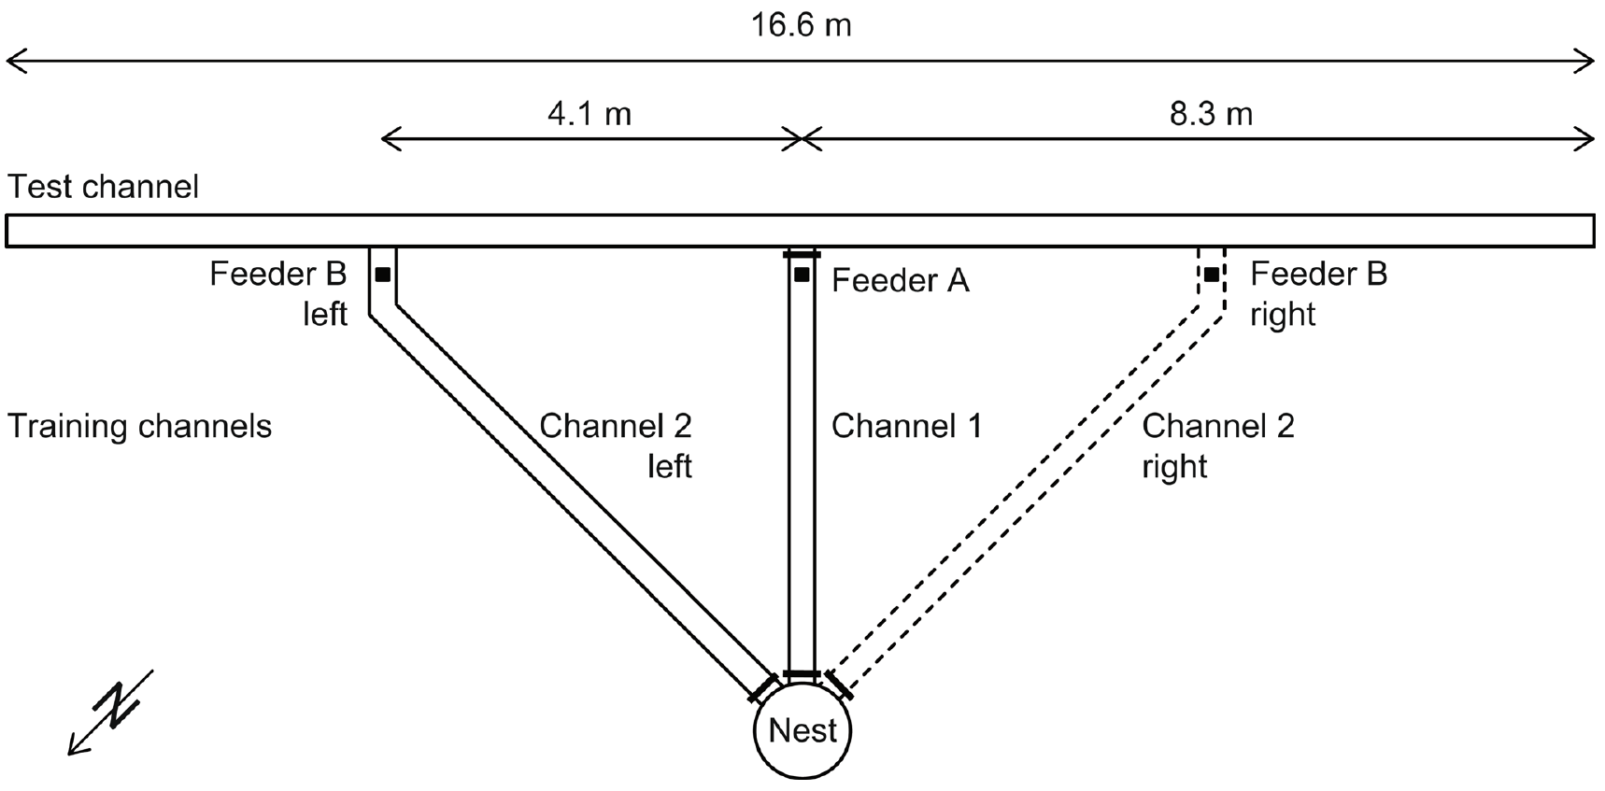
A new route can emerge from familiar goal vectors
A goal vector specifies a remembered direction and distance to a destination relative to the nest. A shortcut connects familiar destinations along a route that was never traveled during training, and this behavior can arise from stored vectors. The shortcut is therefore a new route between two feeders that the ant reached separately.
Voegeli and colleagues trained Cataglyphis ants to feeders A and B in separate channels. The nest distances were 4.5 m and 5.7 m, and the test channel connected the feeder positions across a 4.1 m separation. One nest-channel entrance was open at a time. Each feeder was reached through its own channel during training.
The channel arrangement separated experience with individual nest-to-feeder routes from experience with the connecting route. It provided a controlled way to test use of stored goals and an ongoing path integrator. The design uses controlled routes so that stored goal vectors can be tested directly. The test therefore probed the stored feeder vectors directly.
Voegeli et al. (2025), Fig. 1. Training channels, two feeders and the novel connecting route.
Voegeli et al. (2025)
38
Notes:
• A **goal vector** specifies a remembered direction and distance to a destination relative to the nest. A **shortcut** connects familiar destinations along a route that was not itself used during training; this behavior need not uniquely imply a metric cognitive map.
• Voegeli and colleagues trained Cataglyphis ants to feeders A and B in separate channels. The nest distances were 4.5 m and 5.7 m, and the test channel connected the feeder positions across a 4.1 m separation. Only one nest-channel entrance was open at a time.
• The channel arrangement separated experience with individual nest-to-feeder routes from experience with their connecting route. It provided a controlled way to test use of stored goals and an ongoing path integrator without first training the ant to follow the proposed shortcut.
References:
Voegeli B, Sommer S, Knaden M, Wehner R (2025). Vector-based navigation in desert ants: the significance of path-integration vectors. Journal of Comparative Physiology A 211:209–220. https://doi.org/10.1007/s00359-024-01725-2
Figure: Voegeli et al. (2025), Fig. 1. Training channels, two feeders and the novel connecting route.
Figure source: https://doi.org/10.1007/s00359-024-01725-2

Slide 51
Alternating training establishes two separate destinations
Experience with more than one food source can establish alternative navigational goals. Feeders were hidden below the channel floor, so an approaching ant had no visible food cup to steer toward. The feeders' concealment forced the ant to rely on remembered positions. Its steering depended on what it had learned earlier.
The final visits standardized the starting goal while preserving experience with the second destination. The channel shutters restricted which route was available. The ant still chooses its search directions inside the connecting channel rather than being forced into one turn. The shutters determined which route was open without fixing the first turn.
The design therefore tests stored destinations under controlled routes. A shutter restricted the route, so the first choice came from memory. The first turn reflects the ant's own choice rather than a forced direction. The first turn is therefore a readout of the stored goal. The ant chooses freely within the connecting channel.
Voegeli et al. (2025), Fig. 1. Training channels, two feeders and the novel connecting route.
Voegeli et al. (2025)
39
Notes:
• Experience with more than one food source can establish alternative navigational goals. In the channel experiment, feeders were hidden below the channel floor, preventing an approaching ant from simply steering toward a visible food cup.
• Ants completed ten training journeys: four to feeder A, four to B and two final journeys to A. Feeder B lay 45° to the left or right of A as viewed from the nest. The subsequent test removed food and opened the connecting test channel at A.
• The final visits standardized the starting goal while preserving experience with the second destination. Channel shutters constrained which route was available, but the design still allows the ant to choose search directions within the connecting channel rather than forcing a particular first turn.
References:
Voegeli B, Sommer S, Knaden M, Wehner R (2025). Vector-based navigation in desert ants: the significance of path-integration vectors. Journal of Comparative Physiology A 211:209–220. https://doi.org/10.1007/s00359-024-01725-2
Figure: Voegeli et al. (2025), Fig. 1. Training channels, two feeders and the novel connecting route.
Figure source: https://doi.org/10.1007/s00359-024-01725-2

Slide 52
Ten training journeys set up two feeders
Ants completed ten training journeys: four to feeder A, four to B and two final journeys to A. Feeder B lay 45° to the left or right of A as viewed from the nest. Each feeder had its own channel leading from the nest during training. The nest-to-feeder channels were separated from the connecting channel.
The subsequent test removed food and opened the connecting test channel at A. At any moment, a single nest-channel entrance was open. Its distances from the nest were 4.5 m to A and 5.7 m to B. The connecting channel was new to the ants. The test then measured where the searches concentrated.
Feeder B was placed on either side of A in separate test arrangements. A shortcut links familiar destinations through a route that the ant never used during training. Feeder B's test arrangements placed it left or right of A in balanced fashion. The left and right placements were both tested.
Voegeli et al. (2025), Fig. 1. Training channels, two feeders and the novel connecting route.
Voegeli et al. (2025)
39a
Notes:
• Ten training journeys set up two feeders.
• Explanation 1.
– Ants completed ten training journeys: four to feeder A, four to B and two final journeys to A
– Feeder B lay 45° to the left or right of A as viewed from the nest. Each feeder had its own channel leading from the nest during training. The nest-to-feeder channels were separated from the connecting channel.
• Explanation 2.
– The subsequent test removed food and opened the connecting test channel at A
– At any moment, a single nest-channel entrance was open. Its distances from the nest were 4.5 m to A and 5.7 m to B. The connecting channel was new to the ants. The test then measured where the searches concentrated.
• Explanation 3.
– Feeder B was placed on either side of A in separate test arrangements
– A shortcut links familiar destinations through a route that the ant never used during training. Feeder B's test arrangements placed it left or right of A in balanced fashion. The left and right placements were both tested.
• Source.
– The figure and the measurements come from Voegeli et al. (2025).
– Each statement is tied to the recordings or observations of that study.
References:
Voegeli B, Sommer S, Knaden M, Wehner R (2025). Vector-based navigation in desert ants: the significance of path-integration vectors. Journal of Comparative Physiology A 211:209–220. https://doi.org/10.1007/s00359-024-01725-2

Slide 53
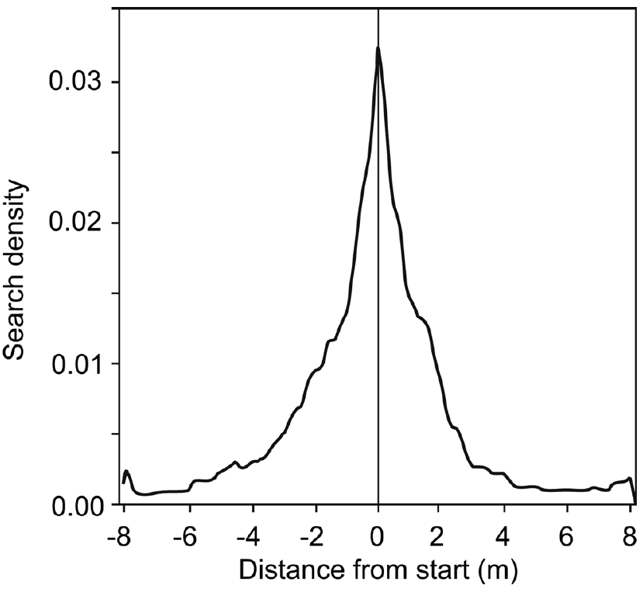
One-feeder training produces a symmetric local search
A one-feeder control establishes the search pattern expected without memory of a second food source. This control allows a general tendency to widen a search to be told apart from a directional bias toward another learned destination. The baseline shows the search expected in the absence of any second goal.
Control ants visited feeder A before testing. After food removal, their searches concentrated around the former feeder position and spread roughly symmetrically on its two sides. Distance from the starting point was measured in metres along the connecting channel. The baseline was measured under the same food-removal procedure. The symmetric pattern forms the reference for interpreting two-feeder data.
Because the baseline is symmetric, a later directional shift in two-feeder ants is measured against a neutral reference. A density distribution indexes where ants search, which is a behavioral readout. The symmetric baseline therefore sets the reference for each comparison. The two-feeder results are judged against this same baseline. Symmetric controls therefore make the two-feeder bias interpretable.
Voegeli et al. (2025), Fig. 2. Symmetric search after training to one feeder.
Voegeli et al. (2025)
40
Notes:
• A one-feeder control establishes the search pattern expected without memory of a second food source. This comparison distinguishes a general tendency to widen a search from a directional bias toward another learned destination.
• Control ants visited only feeder A before testing. After food removal, their searches were concentrated around the former feeder position and distributed approximately symmetrically on its two sides. Distance from the starting point was measured in metres along the connecting test channel.
• The symmetric baseline constrains interpretations of the two-feeder experiments. A later directional shift cannot be attributed simply to entering that channel, although a density distribution still describes where ants search rather than directly measuring the neural representation of a food vector.
References:
Voegeli B, Sommer S, Knaden M, Wehner R (2025). Vector-based navigation in desert ants: the significance of path-integration vectors. Journal of Comparative Physiology A 211:209–220. https://doi.org/10.1007/s00359-024-01725-2
Figure: Voegeli et al. (2025), Fig. 2. Symmetric search after training to one feeder.
Figure source: https://doi.org/10.1007/s00359-024-01725-2

Slide 54
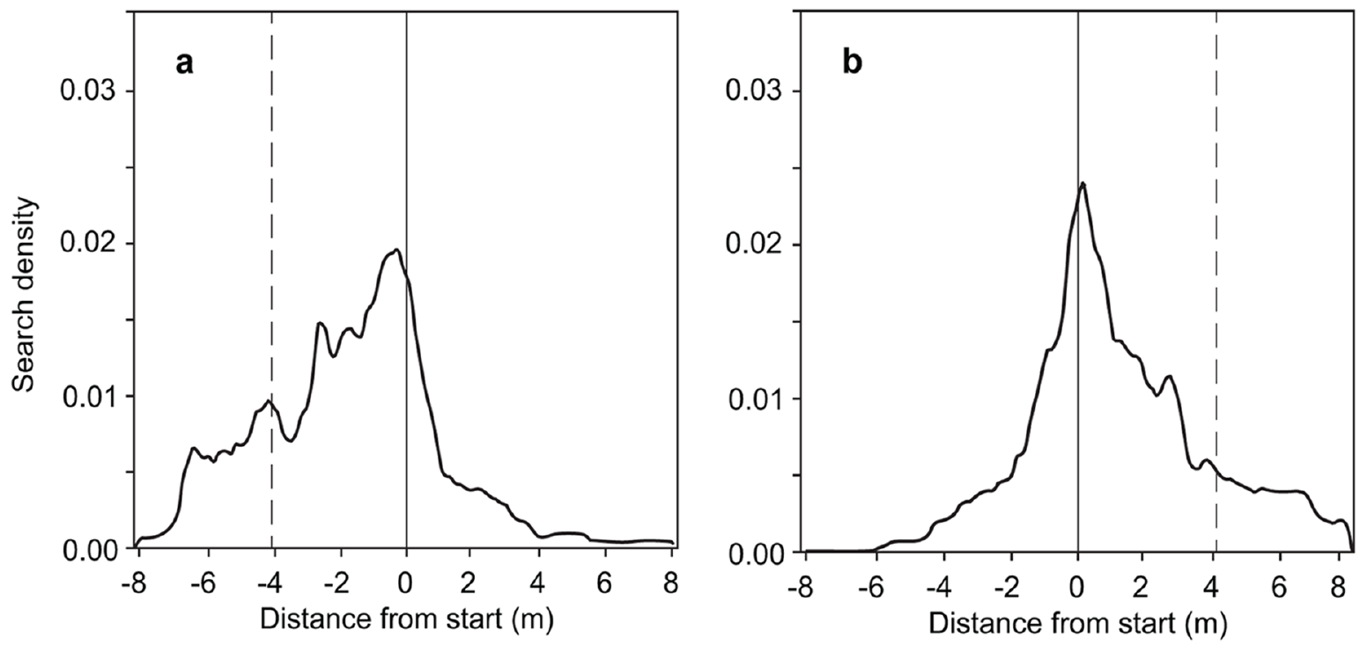
Two-feeder experience biases the first search direction
The first U-turn after the missing feeder measures an early component of search direction. It differs from the full spatial distribution accumulated during later back-and-forth movements in the test channel. Early direction and the total search distribution are separate measurements. The first U-turn is a short, early movement after the feeder is absent.
After training to A and B, about two-thirds of the ants made their first U-turn on the side containing the second feeder. The effect appeared with feeder B either left or right of A, so the bias followed the feeder's location. The result held for feeder B on either side of A.
The left-right symmetry of this effect argues against an intrinsic turning preference. The early bias is consistent with use of an alternative learned goal. First turns reveal that goal's influence before later searching. The early bias reflects a choice among alternatives in the first turn. Each left-right condition was measured with its own feeder arrangement.
Voegeli et al. (2025), Fig. 3(a–b). Search shifts toward the second feeder on either side.
Voegeli et al. (2025)
41
Notes:
• The first U-turn after the missing feeder measures an early component of search direction. It is distinct from the full spatial distribution accumulated during later back-and-forth movements in the test channel.
• After training to A and B, about two-thirds of the ants made their first U-turn on the side containing the second feeder. The effect occurred with feeder B either left or right of A, whose trained positions were separated by 4.1 m.
• The left–right comparison argues against an intrinsic turning preference accounting for the result. The early bias is consistent with using an alternative learned goal, but a first turn alone does not establish arrival accuracy or distinguish all possible computations involving current and remembered vectors.
References:
Voegeli B, Sommer S, Knaden M, Wehner R (2025). Vector-based navigation in desert ants: the significance of path-integration vectors. Journal of Comparative Physiology A 211:209–220. https://doi.org/10.1007/s00359-024-01725-2
Figure: Voegeli et al. (2025), Fig. 3(a–b). Search shifts toward the second feeder on either side.
Figure source: https://doi.org/10.1007/s00359-024-01725-2

Slide 55
Search expands preferentially toward the missing goal
The full search trajectory contains information beyond its first movement. Ants can begin at the expected position of one feeder and then redistribute their efforts toward another destination when the first food source is absent. Such redistribution appears when the first goal fails to provide food. Redistribution follows from the stored goal rather than from food at the location.
Two-feeder ants initially searched around A and progressively widened their searches toward B. Their search-density distributions were asymmetric toward the second feeder, while one-feeder controls stayed symmetric. The asymmetry reversed when feeder B moved to the other side, matching its new location. The asymmetry therefore tracked the position of the second feeder, not the channel side.
Redistribution therefore follows from the stored goal rather than from food present at the location. The behavior points to stored vector information rather than a landmark-based representation of the connecting space. Flexible use of prior destination experience is therefore the central result. The connecting space was searched through stored vectors rather than landmark cues.
Voegeli et al. (2025), Fig. 3(a–b). Search shifts toward the second feeder on either side.
Voegeli et al. (2025)
42
Notes:
• The full search trajectory contains information beyond its first movement. Ants can begin at the expected position of one feeder, then redistribute their efforts toward another destination when the first food source is absent.
• Two-feeder ants initially searched around A but progressively widened their searches toward B. Their search-density distributions were asymmetric in the direction of the second feeder, whereas the one-feeder controls were symmetric. The effect reversed when B changed from the left to the right side.
• The evidence supports flexible use of prior destination experience without requiring prior travel along A-to-B. It does not demonstrate a landmark-based representation of the connecting space, because the channel experiment was designed around controlled routes and stored vector information.
References:
Voegeli B, Sommer S, Knaden M, Wehner R (2025). Vector-based navigation in desert ants: the significance of path-integration vectors. Journal of Comparative Physiology A 211:209–220. https://doi.org/10.1007/s00359-024-01725-2
Figure: Voegeli et al. (2025), Fig. 3(a–b). Search shifts toward the second feeder on either side.
Figure source: https://doi.org/10.1007/s00359-024-01725-2

Slide 56
Symmetric controls set the baseline for the bias
Control ants visited feeder A alone before the test. Once food was removed, their searches centered on the old feeder and spread roughly evenly to both sides. Their distribution served as the baseline for the two-feeder searches. Without a second food source in memory, one-feeder controls show the expected search pattern.
About two-thirds of two-feeder ants turned first toward the side where the second feeder sat. The effect appeared whichever side feeder B occupied. Stored goals persist across journeys, while the current vector updates during travel.
Searches were scored as distances in metres from the start along the connecting channel. The first U-turn is an early movement, separate from the later back-and-forth searching. The searches were recorded as density distributions over the channel.
Voegeli et al. (2025), Fig. 3(a–b). Search shifts toward the second feeder on either side.
Voegeli et al. (2025)
42a
Notes:
• Symmetric controls set the baseline for the bias.
• Explanation 1.
– Control ants visited feeder A alone before the test
– Once food was removed, their searches centered on the old feeder and spread roughly evenly to both sides. Their distribution served as the baseline for the two-feeder searches. Without a second food source in memory, one-feeder controls show the expected search pattern.
• Explanation 2.
– About two-thirds of two-feeder ants turned first toward the side where the second feeder sat
– The effect appeared whichever side feeder B occupied. Stored goals persist across journeys, while the current vector updates during travel.
• Explanation 3.
– Searches were scored as distances in metres from the start along the connecting channel
– The first U-turn is an early movement, separate from the later back-and-forth searching. The searches were recorded as density distributions over the channel.
• Source.
– The figure and the measurements come from Voegeli et al. (2025).
– Each statement is tied to the recordings or observations of that study.
References:
Voegeli B, Sommer S, Knaden M, Wehner R (2025). Vector-based navigation in desert ants: the significance of path-integration vectors. Journal of Comparative Physiology A 211:209–220. https://doi.org/10.1007/s00359-024-01725-2

Slide 57
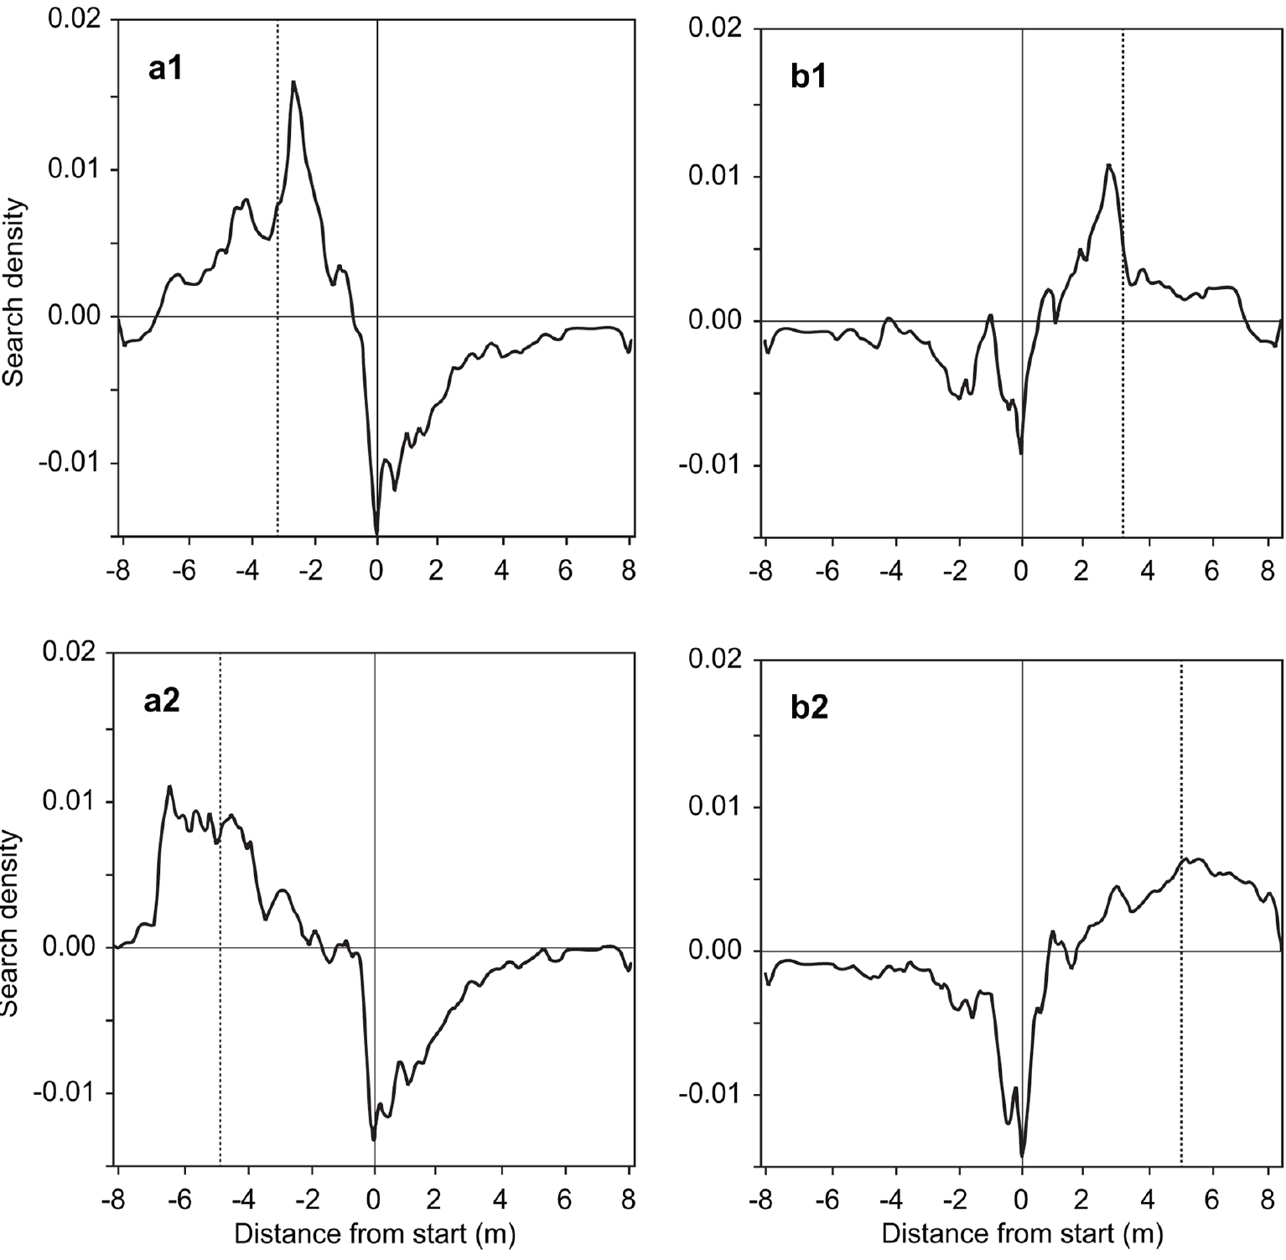
Restricted sky views predict biases in goal searches
A narrow channel restricts the visible portion of the polarization pattern. Depending on channel orientation and solar position, this restriction biases the compass information used during outbound acquisition. The biased information can therefore alter a stored goal vector. Channel walls thus limit which part of the sky the ant sees.
Voegeli and colleagues separated tests into conditions predicting underestimation or overestimation of the A-to-B distance. Subtracting the one-feeder baseline isolates the feeder-specific component of the search. Their positive regions shifted in the predicted direction. Those predictions defined the direction of each expected shift. Each condition predicted a specific direction of error.
The relationship ties the searches to compass information acquired through the channels rather than to the physical location of an absent feeder alone. The searches therefore track compass information acquired in the channels. The positive regions reflect compass information from the channel rather than the feeder site alone. The feeder itself was absent in both conditions.
Voegeli et al. (2025), Fig. 4(a1–b2). Relative search distributions track predicted compass biases.
Voegeli et al. (2025)
43
Notes:
• A narrow channel restricts the visible portion of the polarization pattern. Depending on channel orientation and solar position, this restriction can bias the compass information used during outbound acquisition and therefore alter a stored goal vector.
• Voegeli and colleagues separated tests into conditions predicting underestimation or overestimation of the 4.1 m A-to-B distance. Relative search distributions were obtained by subtracting the one-feeder baseline from the two-feeder distributions. Their positive regions shifted in the predicted direction.
• The relationship links the searches to compass information acquired through the channels rather than merely to the physical location of an absent feeder. The subtraction is an analysis of recorded behavior, not proof that ants themselves subtract search distributions or represent their uncertainty in this format.
References:
Voegeli B, Sommer S, Knaden M, Wehner R (2025). Vector-based navigation in desert ants: the significance of path-integration vectors. Journal of Comparative Physiology A 211:209–220. https://doi.org/10.1007/s00359-024-01725-2
Figure: Voegeli et al. (2025), Fig. 4(a1–b2). Relative search distributions track predicted compass biases.
Figure source: https://doi.org/10.1007/s00359-024-01725-2

Slide 58
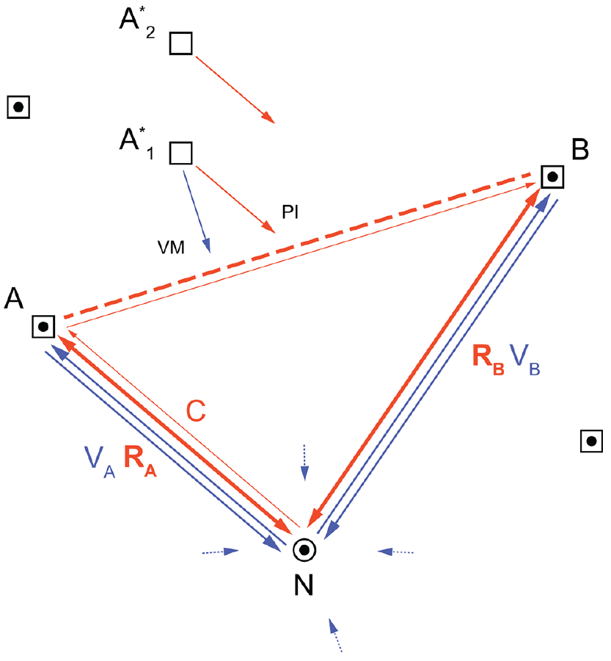
Stored goals can interact with the current home vector
The current vector is updated during ongoing travel, whereas a stored goal vector can persist across journeys. A goal can be approached by comparing the current nest-relative state with a remembered destination. This approach avoids constructing a map of all familiar places. The current state and the stored goal are therefore compared rather than mapped.
In the two-feeder experiment, ants searched toward B from A along an untrained connecting route. The two feeders were separated by 4.1 m. The authors proposed that the food vector for B is retrieved into working memory while the path integrator keeps tracking the ant's current state. Retrieval of B's vector occurs while travel continues.
This account explains the shortcut without invoking a metric cognitive map. The proposal is interpretive, because the behavioral experiment establishes the search pattern. Working-memory neurons and the synaptic storage of A and B remain for future identification. The shortcut is thus explained by two stored and continuous signals. The explanation fits the observed route without extra assumptions.
Voegeli et al. (2025), Fig. 5. Published framework relating current, stored and view-based vectors.
Voegeli et al. (2025)
44
Notes:
• The **current vector** is updated during ongoing travel, whereas a stored goal vector can persist across journeys. A goal can be approached by comparing the current nest-relative state with a remembered destination rather than constructing a map of all familiar places.
• In the two-feeder experiment, ants searched toward B from A along an untrained connecting route separated by 4.1 m. The authors proposed retrieval of B’s food vector into working memory while the path integrator continued to track the ant’s current state.
• This account explains the shortcut without requiring a metric cognitive map. It remains an interpretation of behavioral results: the experiment did not record a working-memory neuron, isolate synaptic storage of A and B, or decisively exclude every alternative form of vector computation.
References:
Voegeli B, Sommer S, Knaden M, Wehner R (2025). Vector-based navigation in desert ants: the significance of path-integration vectors. Journal of Comparative Physiology A 211:209–220. https://doi.org/10.1007/s00359-024-01725-2
Figure: Voegeli et al. (2025), Fig. 5. Published framework relating current, stored and view-based vectors.
Figure source: https://doi.org/10.1007/s00359-024-01725-2

Slide 59
A shortcut does not uniquely establish a cognitive map
A metric cognitive map represents spatial relationships among familiar places in a common coordinate system. Novel shortcutting is often treated as evidence for such a map. The same behavior can follow from simpler stored vectors and continuous self-motion updating. A metric map would include the spatial relations among several familiar places.
Cataglyphis ants trained separately to feeders 4.5 m and 5.7 m from the nest searched along their previously untraveled connecting route. The controlled A-to-B test demonstrated flexible navigation toward a second goal. The route had no training history, so the shortcut was never practiced. Each feeder had been trained along its own nest channel.
The behavior is compatible with a nest-referenced vector system and fits that explanation without needing the stronger metric account. Shortcutting therefore identifies flexible navigation, and a unique marker of map-based navigation needs evidence beyond it. Shortcutting alone leaves the two explanations equally consistent. A nest-referenced vector system is therefore sufficient to produce the observed shortcut.
Voegeli et al. (2025), Fig. 5. Published framework relating current, stored and view-based vectors.
Voegeli et al. (2025)
45
Notes:
• A **metric cognitive map** represents spatial relationships among familiar places in a common coordinate system. Novel shortcutting is often treated as evidence for such a map, but the same behavior can sometimes follow from simpler stored vectors and continuous self-motion updating.
• Cataglyphis ants trained separately to feeders 4.5 m and 5.7 m from the nest searched along their previously untraveled connecting route. The controlled A-to-B test demonstrated flexible navigation toward a second goal without requiring prior experience of that particular route.
• The finding makes shortcutting insufficient as a unique diagnostic of map-based navigation. It does not prove that ants can never form other spatial representations; it specifies that this observed behavior is compatible with a nest-referenced vector system and does not require the stronger explanation.
References:
Voegeli B, Sommer S, Knaden M, Wehner R (2025). Vector-based navigation in desert ants: the significance of path-integration vectors. Journal of Comparative Physiology A 211:209–220. https://doi.org/10.1007/s00359-024-01725-2
Figure: Voegeli et al. (2025), Fig. 5. Published framework relating current, stored and view-based vectors.
Figure source: https://doi.org/10.1007/s00359-024-01725-2

Slide 60
Key takeaways
Home vectors combine direction and distance acquired during movement; they differ from retracing the outward route.
Controlled displacement reveals a stored movement-derived estimate by separating the expressed vector from the true nest position.
Stride-dependent odometry is supported by stilt overshoot, stump undershoot and recovery when outbound and inbound leg conditions match.
Compass learning depends on changing celestial information during early learning walks and is associated with region-specific structural plasticity.
Magnetic reference signals affect nest-directed gazes and brain plasticity differently; the magnetic receptor and causal cellular mechanisms remain unresolved.
Novel shortcuts can arise from stored goal vectors interacting with an ongoing path integrator, so shortcutting alone does not establish a cognitive map.
Müller & Wehner (1988); Wittlinger et al. (2007); Grob et al. (2022, 2024); Voegeli et al. (2025)
46
Notes:
Teaching transcript:
• Home vectors combine direction and distance acquired during movement; they differ from retracing the outward route.
• Controlled displacement reveals a stored movement-derived estimate by separating the expressed vector from the true nest position.
• Stride-dependent odometry is supported by stilt overshoot, stump undershoot and recovery when outbound and inbound leg conditions match.
• Compass learning depends on changing celestial information during early learning walks and is associated with region-specific structural plasticity.
• Magnetic reference signals affect nest-directed gazes and brain plasticity differently; the magnetic receptor and causal cellular mechanisms remain unresolved.
• Novel shortcuts can arise from stored goal vectors interacting with an ongoing path integrator, so shortcutting alone does not establish a cognitive map.
References:
Müller M, Wehner R (1988). Path integration in desert ants, Cataglyphis fortis. Proceedings of the National Academy of Sciences 85(14):5287–5290. https://doi.org/10.1073/pnas.85.14.5287
Wittlinger M, Wehner R, Wolf H (2006). The Ant Odometer: Stepping on Stilts and Stumps. Science 312(5782):1965–1967. https://doi.org/10.1126/science.1126912
Wittlinger M, Wehner R, Wolf H (2007). The desert ant odometer: a stride integrator that accounts for stride length and walking speed. Journal of Experimental Biology 210(2):198–207. https://doi.org/10.1242/jeb.02657
Grob R, Holland Cunz O, Grübel K, Pfeiffer K, Rössler W, Fleischmann PN (2022). Rotation of skylight polarization during learning walks is necessary to trigger neuronal plasticity in Cataglyphis ants. Proceedings of the Royal Society B 289:20212499. https://doi.org/10.1098/rspb.2021.2499
Grob R, Müller VL, Grübel K, Rössler W, Fleischmann PN (2024). Importance of magnetic information for neuronal plasticity in desert ants. Proceedings of the National Academy of Sciences 121(8):e2320764121. https://doi.org/10.1073/pnas.2320764121
Voegeli B, Sommer S, Knaden M, Wehner R (2025). Vector-based navigation in desert ants: the significance of path-integration vectors. Journal of Comparative Physiology A 211:209–220. https://doi.org/10.1007/s00359-024-01725-2

