Slide 1
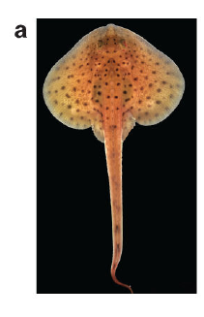
NEUR 411 · NEUROETHOLOGY · FALL 2026
Lecture 20
Electroreception I: passive sensing in sharks and rays (ampullae of Lorenzini)
Monday, October 12, 2026
Jordan Lopez, Ph.D.
Professor of Neurobiology & Biomedical Engineering
Bellono et al. (2017), Fig. 1(a). Little skate (Leucoraja erinacea).
Notes:
Electroreception I: passive sensing in sharks and rays (ampullae of Lorenzini)
Lecture 20. NEUR 411 · NEUROETHOLOGY · FALL 2026. Monday, October 12, 2026.
Figure: Bellono et al. (2017), Fig. 1(a). Little skate (Leucoraja erinacea).
Figure source: https://doi.org/10.1038/nature21401
• The little skate is one of the experimental animals studied here; the title image is an unmodified published photograph.
References:
Bellono NW, Leitch DB, Julius D (2017). Molecular basis of ancestral vertebrate electroreception. Nature 543(7645):391-396. https://doi.org/10.1038/nature21401

Slide 2
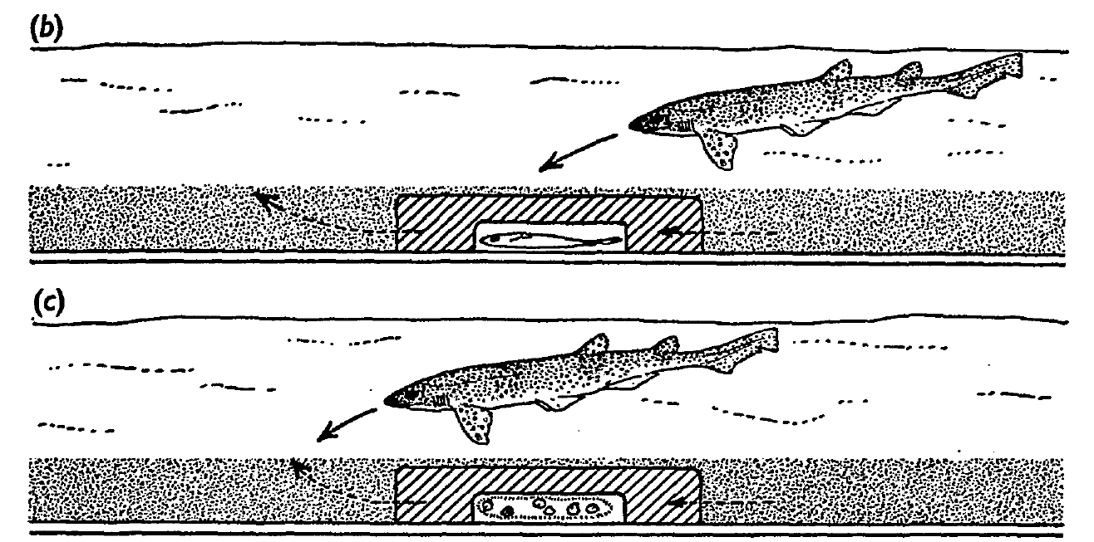
Hidden prey are located through their electric fields
Passive electroreception is detection of electric fields produced outside the sensing animal, without probing the environment with its own discharge. Kalmijn tested feeding in small-spotted catsharks, Scyliorhinus canicula, and thornback rays, Raja clavata, using living plaice concealed beneath sand.
Catsharks made directed feeding turns when they passed within approximately 15 cm of buried prey. Because sand could still transmit odor and water movements, concealment alone did not isolate the sensory cue. Kalmijn therefore enclosed the plaice in electrically conductive agar and manipulated the information escaping from it.
Predators continued attacking the concealed living fish through agar, whereas pieces of whiting redirected searching toward the chamber’s water outlet. Electrical localization and odor-induced feeding motivation were experimentally separable. The result establishes short-range use of prey fields under these conditions, rather than unlimited detection through seawater.
Kalmijn (1971), Fig. 2(b–c). Agar screening separates living prey from odor controls.
Kalmijn (1971)
02
Notes:
• Passive electroreception is detection of electric fields produced outside the sensing animal, without probing the environment with its own discharge. Kalmijn tested feeding in small-spotted catsharks, Scyliorhinus canicula, and thornback rays, Raja clavata, using living plaice concealed beneath sand.
– The plaice was a naturalistic bottom-dwelling prey item, 8–15 cm long. Whiting juice distributed through the pool promoted food searching without marking the prey’s precise location. The experimental question concerned directed attacks, rather than whether an animal could merely register the presence of another fish.
• Catsharks made directed feeding turns when they passed within approximately 15 cm of buried prey. Because sand could still transmit odor and water movements, concealment alone did not isolate the sensory cue. Kalmijn therefore enclosed the plaice in electrically conductive agar and manipulated the information escaping from it.
• Predators continued attacking the concealed living fish through agar, whereas pieces of whiting redirected searching toward the chamber’s water outlet. Electrical localization and odor-induced feeding motivation were experimentally separable. The result establishes short-range use of prey fields under these conditions, rather than unlimited detection through seawater.
References:
Kalmijn AJ (1971). The Electric Sense of Sharks and Rays. Journal of Experimental Biology 55(2):371-383. https://doi.org/10.1242/jeb.55.2.371
Figure: Kalmijn (1971), Fig. 2(b–c). Agar screening separates living prey from odor controls.
Figure source: https://doi.org/10.1242/jeb.55.2.371

Slide 3
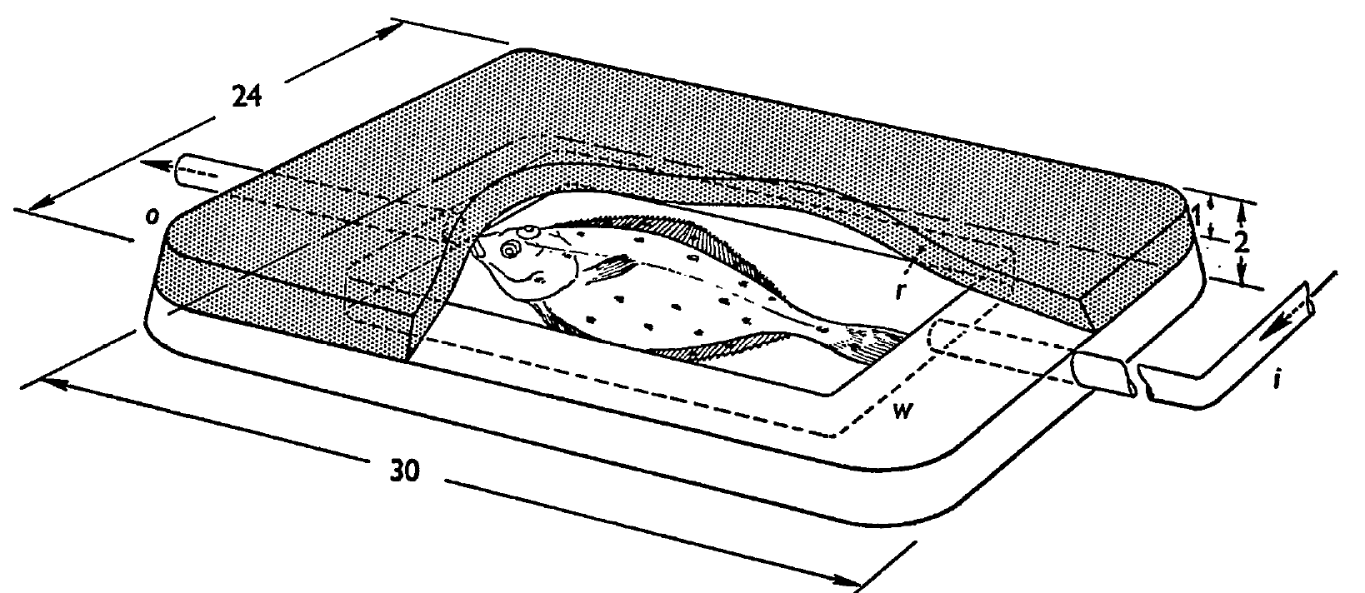
Conductive agar isolates the prey’s electrical cue
An electric field is a spatial voltage gradient that can drive current through a conductor. Kalmijn constructed a chamber from 3% agar in seawater, with thick sidewalls, a reinforced roof, and inlet and outlet tubes supplying the enclosed plaice with fresh seawater.
The chamber concealed the fish and attenuated mechanical disturbances while remaining conductive. A 1-Hz test current of 120 µA passed between electrodes 5 cm apart; field measurements with and without the chamber differed by no more than the reported 3% measurement limit.
Water carried potential odorants toward the outlet, yet attacks on living plaice were directed toward the agar-covered head region. The conductivity measurement was an essential control: a barrier cannot isolate an electrical cue unless its effect on that cue is tested independently. Agar screening reduced competing cues without denervating the predator.
Kalmijn (1971), Fig. 1. Conductive agar chamber and seawater circulation.
Kalmijn (1971)
03
Notes:
• An electric field is a spatial voltage gradient that can drive current through a conductor. Kalmijn constructed a chamber from 3% agar in seawater, with thick sidewalls, a reinforced roof, and inlet and outlet tubes supplying the enclosed plaice with fresh seawater.
– The plastic pools and electrically isolated circulation system avoided metal-generated galvanic fields. Agar structures equilibrated in the pool for at least 12 hours. These preparation details reduced unintended electrical targets and helped assign the response to the experimentally enclosed source.
• The chamber concealed the fish and attenuated mechanical disturbances while remaining conductive. A 1-Hz test current of 120 µA passed between electrodes 5 cm apart; field measurements with and without the chamber differed by no more than the reported 3% measurement limit.
• Water carried potential odorants toward the outlet, yet attacks on living plaice were directed toward the agar-covered head region. The conductivity measurement was an essential control: a barrier cannot isolate an electrical cue unless its effect on that cue is tested independently. Agar screening reduced competing cues without denervating the predator.
References:
Kalmijn AJ (1971). The Electric Sense of Sharks and Rays. Journal of Experimental Biology 55(2):371-383. https://doi.org/10.1242/jeb.55.2.371
Figure: Kalmijn (1971), Fig. 1. Conductive agar chamber and seawater circulation.
Figure source: https://doi.org/10.1242/jeb.55.2.371

Slide 4
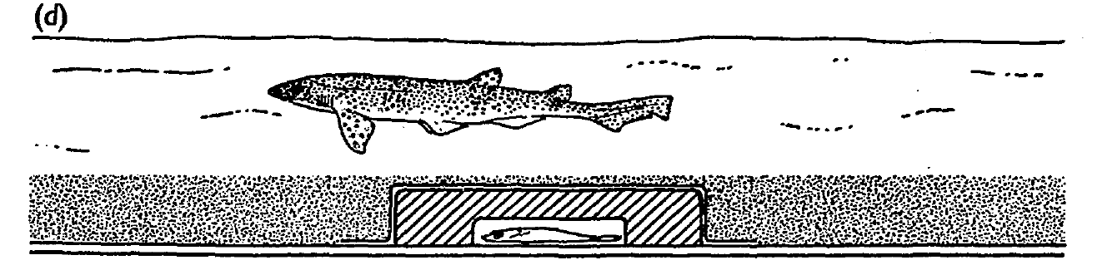
Electrical insulation abolishes directed attacks
Kalmijn covered the conductive agar chamber with polyethylene approximately 10 µm thick, then replaced the sand. The living plaice remained inside, and diffuse whiting odor still motivated the predators to search. The critical manipulation was electrical insulation around an otherwise similar concealed target.
Catsharks and rays passed close to the shielded fish without directed feeding responses. Removing the plastic restored attacks in control trials. The film had an area-specific resistance near 10¹² Ω·cm² and capacitance below 200 pF/cm², strongly attenuating direct-current and low-frequency fields.
The thin film added relatively little mechanical shielding compared with the reinforced agar roof. Reversible loss of localization therefore supports electrical guidance rather than an explanation based solely on sight, odor, or prey movement. This behavioral manipulation identifies a necessary available cue without measuring individual receptor-cell conductances.
Kalmijn (1971), Fig. 2(d). Electrical shielding blocks directed attacks.
Kalmijn (1971)
04
Notes:
• Kalmijn covered the conductive agar chamber with polyethylene approximately 10 µm thick, then replaced the sand. The living plaice remained inside, and diffuse whiting odor still motivated the predators to search. The critical manipulation was electrical insulation around an otherwise similar concealed target.
– The same predator could search vigorously while failing to localize the shielded plaice. Motivation and sensory access were thus distinct variables. Restoration after removing the film also limited explanations based on fatigue, permanent sensory injury, or an irreversible change in the prey.
• Catsharks and rays passed close to the shielded fish without directed feeding responses. Removing the plastic restored attacks in control trials. The film had an area-specific resistance near 10¹² Ω·cm² and capacitance below 200 pF/cm², strongly attenuating direct-current and low-frequency fields.
• The thin film added relatively little mechanical shielding compared with the reinforced agar roof. Reversible loss of localization therefore supports electrical guidance rather than an explanation based solely on sight, odor, or prey movement. This behavioral manipulation identifies a necessary available cue without measuring individual receptor-cell conductances.
References:
Kalmijn AJ (1971). The Electric Sense of Sharks and Rays. Journal of Experimental Biology 55(2):371-383. https://doi.org/10.1242/jeb.55.2.371
Figure: Kalmijn (1971), Fig. 2(d). Electrical shielding blocks directed attacks.
Figure source: https://doi.org/10.1242/jeb.55.2.371

Slide 5
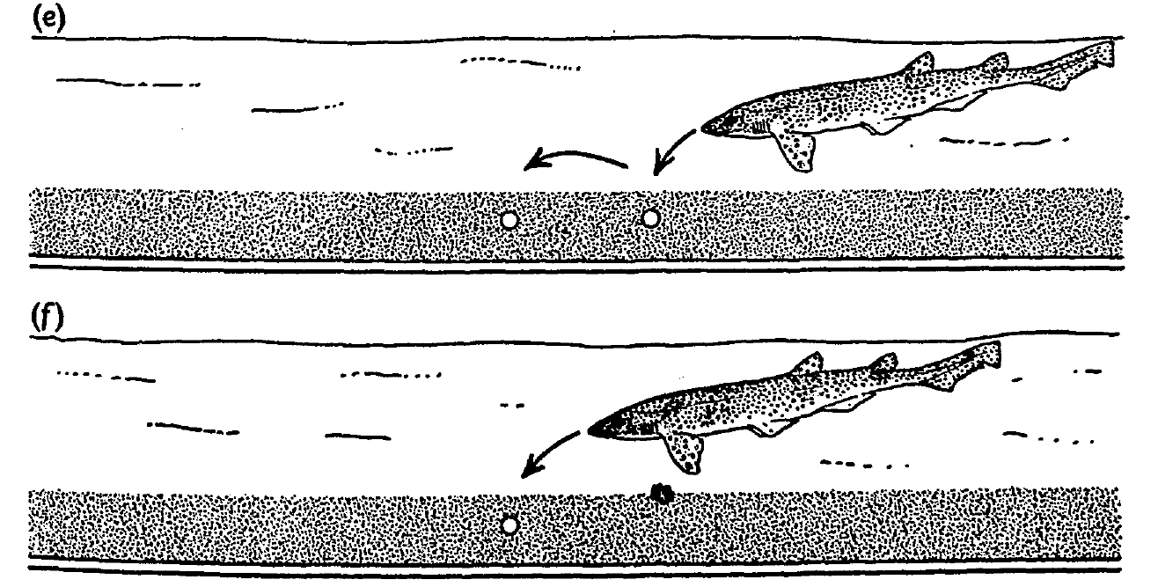
Artificial dipoles are sufficient to direct feeding
An electric dipole consists of a separated current source and sink. Kalmijn buried seawater-bridge outlets beneath sand and passed either a 1-Hz sinusoidal current or direct current of 4 µA between them, approximating the strength of a living plaice’s electrical signal.
After odor-induced arousal, catsharks and rays dug at the active outlets as though attacking prey. Identical buried outlets without current did not elicit these responses. In a competition test, a whiting piece 5 cm from the outlets supplied odor, but directed attacks favored the electrical source.
An artificial field was therefore sufficient for localization, while odor supplied a complementary motivational cue. Current-switching controls excluded the mere presence of electrodes as the target. The experiment does not establish that predators identify prey species from a dipole or that all natural bioelectric signals have the same waveform.
Kalmijn (1971), Fig. 2(e–f). Artificial dipoles elicit attacks and compete with food odor.
Kalmijn (1971)
05
Notes:
• An electric dipole consists of a separated current source and sink. Kalmijn buried seawater-bridge outlets beneath sand and passed either a 1-Hz sinusoidal current or direct current of 4 µA between them, approximating the strength of a living plaice’s electrical signal.
– The electrodes were connected through long seawater bridges to reduce chemical and polarization artifacts near the target. The predators sometimes left the outlets exposed after digging, despite no food reward there. Accurate localization could therefore occur independently of successful prey capture.
• After odor-induced arousal, catsharks and rays dug at the active outlets as though attacking prey. Identical buried outlets without current did not elicit these responses. In a competition test, a whiting piece 5 cm from the outlets supplied odor, but directed attacks favored the electrical source.
• An artificial field was therefore sufficient for localization, while odor supplied a complementary motivational cue. Current-switching controls excluded the mere presence of electrodes as the target. The experiment does not establish that predators identify prey species from a dipole or that all natural bioelectric signals have the same waveform.
References:
Kalmijn AJ (1971). The Electric Sense of Sharks and Rays. Journal of Experimental Biology 55(2):371-383. https://doi.org/10.1242/jeb.55.2.371
Figure: Kalmijn (1971), Fig. 2(e–f). Artificial dipoles elicit attacks and compete with food odor.
Figure source: https://doi.org/10.1242/jeb.55.2.371

Slide 6
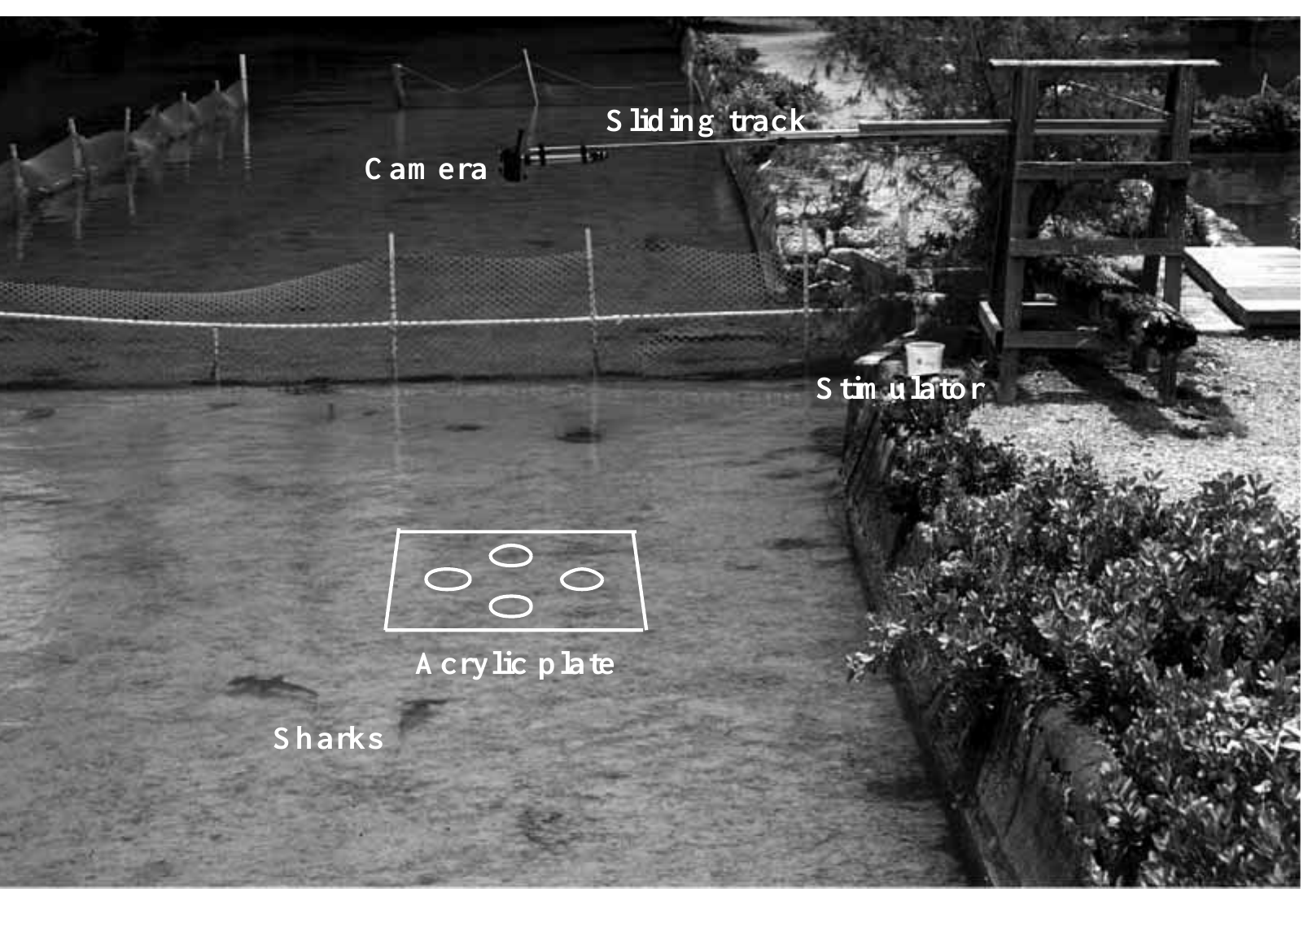
A semi-natural arena measures shark orientation
Kajiura and Holland compared juvenile scalloped hammerheads, Sphyrna lewini, with sandbar sharks, Carcharhinus plumbeus, in an enclosed reef habitat. Both species consume bottom-associated fishes and crustaceans, permitting comparison of similar feeding tasks despite markedly different head shapes.
An overhead camera recorded sharks crossing an acrylic electrode plate in water less than 0.5 m deep. Each shark was isolated from companions during testing. Feeding odor encouraged searching, while electric current selected the active dipole independently of the other inactive targets.
Orientation was identified from a course change greater than 20° or a bite. Calibrated video allowed distance and trajectory measurements rather than relying only on observer descriptions. The semi-natural setting preserved swimming behavior, but odor stimulation and the plate constrained the encounter relative to unconstrained wild hunting.
Kajiura & Holland (2002), Fig. 2. Shallow-water arena, camera and electrode plate.
Kajiura & Holland (2002)
06
Notes:
• Kajiura and Holland compared juvenile scalloped hammerheads, Sphyrna lewini, with sandbar sharks, Carcharhinus plumbeus, in an enclosed reef habitat. Both species consume bottom-associated fishes and crustaceans, permitting comparison of similar feeding tasks despite markedly different head shapes.
– The surrounding pen included reef organisms and tidal exchange. Testing one shark at a time prevented a neighboring shark’s response from supplying the focal animal with an additional directional cue. The study measured behavioral orientation to an artificial prey-like source, rather than intracellular receptor sensitivity.
• An overhead camera recorded sharks crossing an acrylic electrode plate in water less than 0.5 m deep. Each shark was isolated from companions during testing. Feeding odor encouraged searching, while electric current selected the active dipole independently of the other inactive targets.
• Orientation was identified from a course change greater than 20° or a bite. Calibrated video allowed distance and trajectory measurements rather than relying only on observer descriptions. The semi-natural setting preserved swimming behavior, but odor stimulation and the plate constrained the encounter relative to unconstrained wild hunting.
References:
Kajiura SM, Holland KN (2002). Electroreception in juvenile scalloped hammerhead and sandbar sharks. Journal of Experimental Biology 205(23):3609-3621. https://doi.org/10.1242/jeb.205.23.3609
Figure: Kajiura & Holland (2002), Fig. 2. Shallow-water arena, camera and electrode plate.
Figure source: https://doi.org/10.1242/jeb.205.23.3609

Slide 7
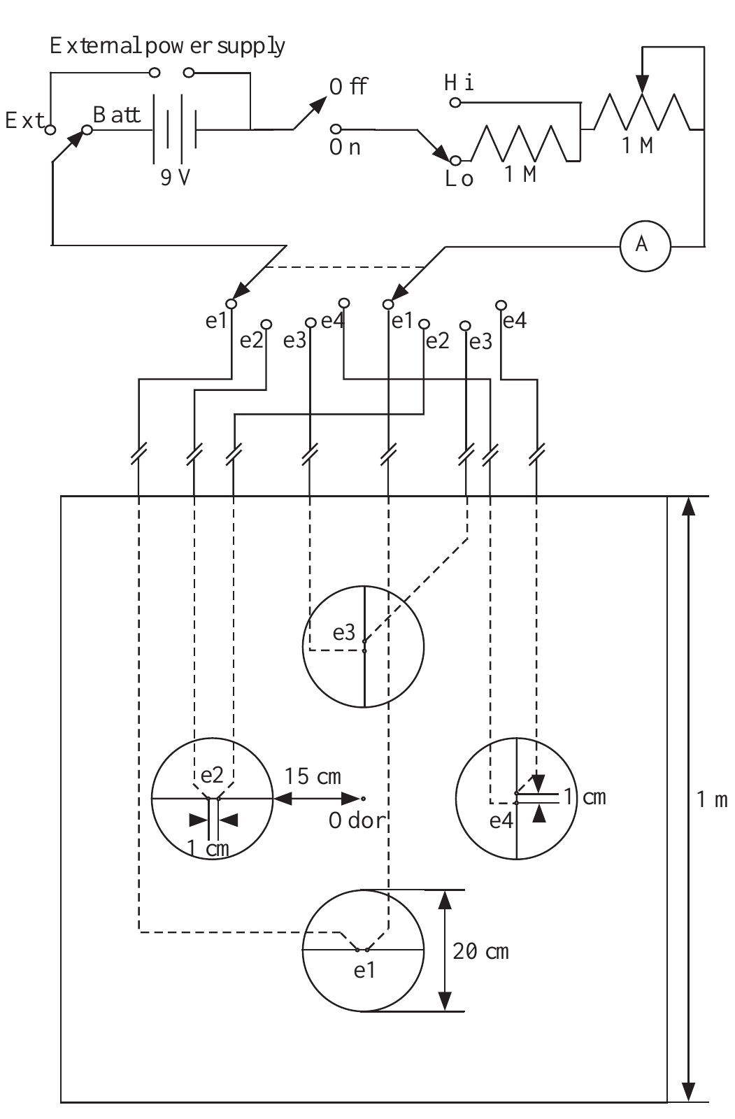
Controlled dipoles separate current from target position
The shark stimulus apparatus delivered a constant current of 6.0 µA through outlets separated by 1 cm. A battery-powered circuit and series ammeter controlled and monitored the stimulus. Four selectable dipoles allowed the experimenter to change the electrical target on the same plate.
Seawater-filled tubing separated the metal electrodes from the nearby swimming animal, reducing local chemical cues. Both species bit the active dipole and ignored inactive dipoles; repeated biting stopped when current was switched off. Target position and electrical activation were therefore independently manipulable.
Current in microamperes describes the source, whereas field strength in microvolts per centimeter describes the local stimulus encountered by the shark. These quantities are not interchangeable. Behavioral sensitivity requires the source geometry, seawater properties, distance, and encounter direction to be considered alongside the measured response.
Kajiura & Holland (2002), Fig. 1. Battery-powered dipole stimulation and electrode array.
Kajiura & Holland (2002)
07
Notes:
• The shark stimulus apparatus delivered a constant current of 6.0 µA through outlets separated by 1 cm. A battery-powered circuit and series ammeter controlled and monitored the stimulus. Four selectable dipoles allowed the experimenter to change the electrical target on the same plate.
– The 1-cm outlet spacing approximated a compact prey source. An ammeter verified delivered current, and the inactive pairs supplied spatial controls within the same apparatus. A shark’s response to the active pair cannot by itself specify the voltage acting across any one ampullary epithelium.
• Seawater-filled tubing separated the metal electrodes from the nearby swimming animal, reducing local chemical cues. Both species bit the active dipole and ignored inactive dipoles; repeated biting stopped when current was switched off. Target position and electrical activation were therefore independently manipulable.
• Current in microamperes describes the source, whereas field strength in microvolts per centimeter describes the local stimulus encountered by the shark. These quantities are not interchangeable. Behavioral sensitivity requires the source geometry, seawater properties, distance, and encounter direction to be considered alongside the measured response.
References:
Kajiura SM, Holland KN (2002). Electroreception in juvenile scalloped hammerhead and sandbar sharks. Journal of Experimental Biology 205(23):3609-3621. https://doi.org/10.1242/jeb.205.23.3609
Figure: Kajiura & Holland (2002), Fig. 1. Battery-powered dipole stimulation and electrode array.
Figure source: https://doi.org/10.1242/jeb.205.23.3609

Slide 8
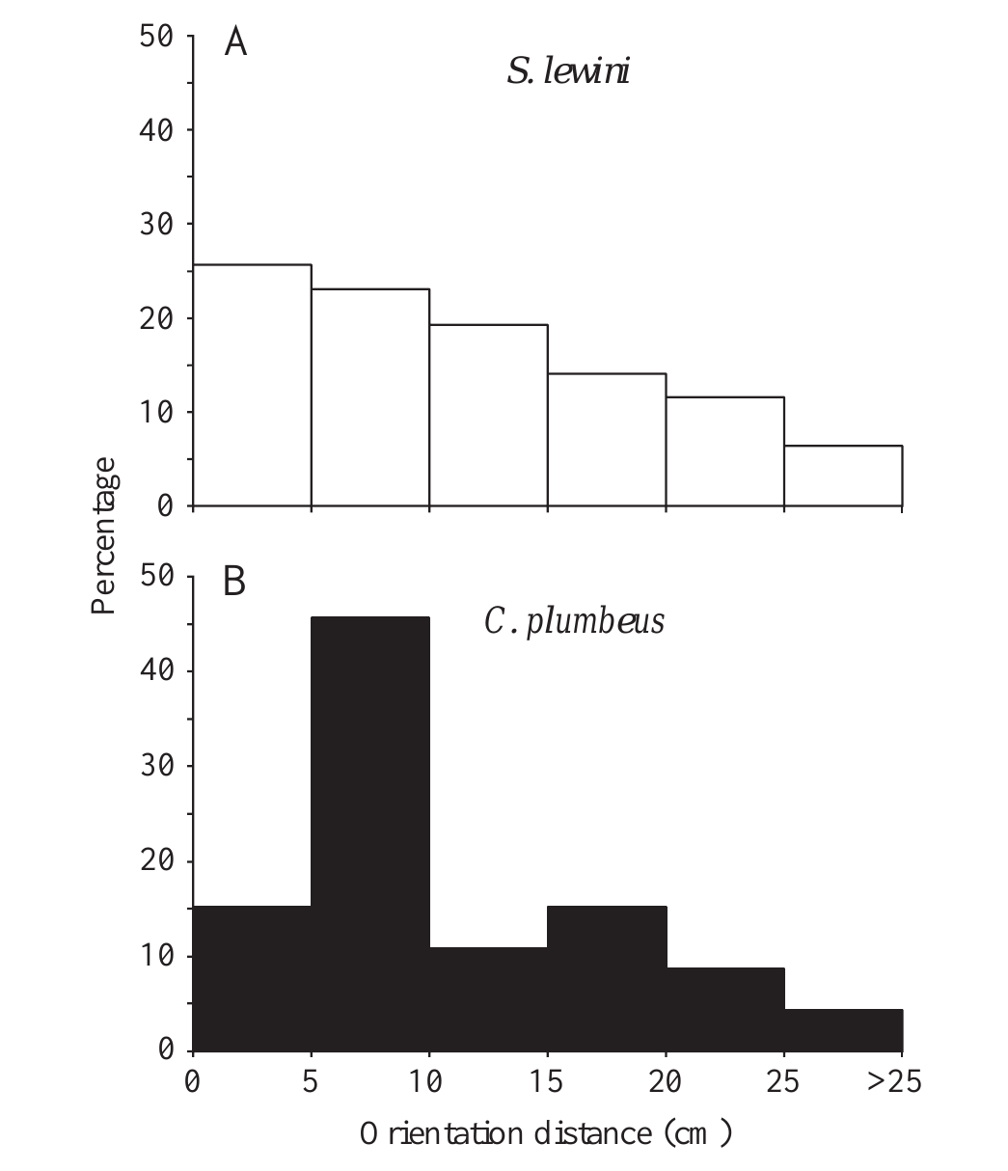
Hammerheads and sandbars have similar detection range
Kajiura and Holland measured distance from the dipole center when a shark initiated a directed turn. Hammerheads most often oriented within 5 cm, whereas sandbars most often oriented within 10 cm. The farthest responses were 30.6 cm and 31.6 cm, respectively.
The nearly identical maximum ranges did not support the prediction that the hammerhead’s expanded head necessarily produces a lower behavioral detection threshold. Both species searched the same apparatus with the same source current and dipole spacing, limiting differences caused by stimulus construction.
Maximum range and the most frequent response distance describe different aspects of performance. An occasional distant orientation does not imply that every encounter is detected there. The result applies to these juvenile species and motivated feeding conditions, rather than establishing identical sensitivity across all sharks or developmental stages.
Kajiura & Holland (2002), Fig. 5(A–B). Orientation distance distributions for both shark species.
Kajiura & Holland (2002)
08
Notes:
• Kajiura and Holland measured distance from the dipole center when a shark initiated a directed turn. Hammerheads most often oriented within 5 cm, whereas sandbars most often oriented within 10 cm. The farthest responses were 30.6 cm and 31.6 cm, respectively.
– The animals’ swimming paths affected when and where they encountered the source. Detection range is consequently an organism-level measure that combines sensory input, movement, and response criteria. Equal farthest distances need not imply identical pore counts, receptor currents, or neural population responses.
• The nearly identical maximum ranges did not support the prediction that the hammerhead’s expanded head necessarily produces a lower behavioral detection threshold. Both species searched the same apparatus with the same source current and dipole spacing, limiting differences caused by stimulus construction.
• Maximum range and the most frequent response distance describe different aspects of performance. An occasional distant orientation does not imply that every encounter is detected there. The result applies to these juvenile species and motivated feeding conditions, rather than establishing identical sensitivity across all sharks or developmental stages.
References:
Kajiura SM, Holland KN (2002). Electroreception in juvenile scalloped hammerhead and sandbar sharks. Journal of Experimental Biology 205(23):3609-3621. https://doi.org/10.1242/jeb.205.23.3609
Figure: Kajiura & Holland (2002), Fig. 5(A–B). Orientation distance distributions for both shark species.
Figure source: https://doi.org/10.1242/jeb.205.23.3609

Slide 9
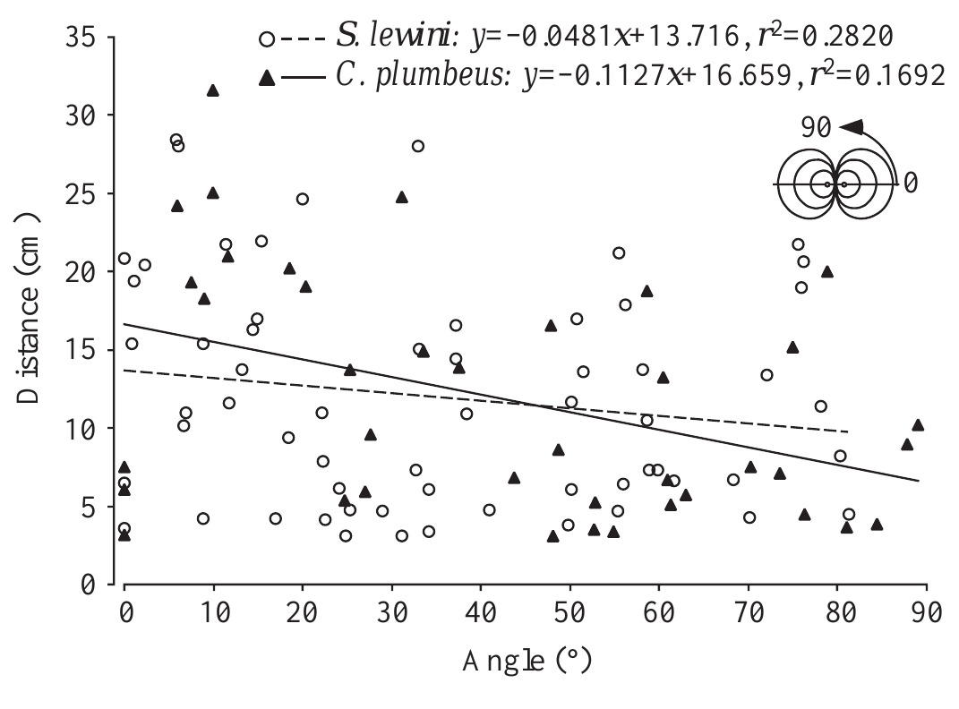
Encounter angle changes the detectable dipole field
A dipole’s field depends on direction as well as distance. Kajiura and Holland measured each shark’s approach angle relative to the line joining the two outlets. Orientations began farther away at smaller angles, where the relevant field component was stronger.
Both hammerheads and sandbars followed this relationship. Approaches nearer 90° required a closer encounter before an orientation began. Comparing orientation distance alone would therefore confound receptor sensitivity with the geometry of the sampled field; angle was needed to estimate the local electrical stimulus.
The two species encountered the source from many directions, so a distant response was not simply evidence of a preferred approach axis. The experiment relates swimming geometry to effective stimulation. It does not directly identify how downstream neurons combine the differing signals available at individual skin pores.
Kajiura & Holland (2002), Fig. 6. Orientation distance depends on dipole-axis angle.
Kajiura & Holland (2002)
09
Notes:
• A dipole’s field depends on direction as well as distance. Kajiura and Holland measured each shark’s approach angle relative to the line joining the two outlets. Orientations began farther away at smaller angles, where the relevant field component was stronger.
– The original article calculated field intensity from a specified dipole model and measured seawater properties. The inference depends on those physical assumptions. Spatial sampling by a moving head also changes receptor input over time, even when the experimental current remains constant.
• Both hammerheads and sandbars followed this relationship. Approaches nearer 90° required a closer encounter before an orientation began. Comparing orientation distance alone would therefore confound receptor sensitivity with the geometry of the sampled field; angle was needed to estimate the local electrical stimulus.
• The two species encountered the source from many directions, so a distant response was not simply evidence of a preferred approach axis. The experiment relates swimming geometry to effective stimulation. It does not directly identify how downstream neurons combine the differing signals available at individual skin pores.
References:
Kajiura SM, Holland KN (2002). Electroreception in juvenile scalloped hammerhead and sandbar sharks. Journal of Experimental Biology 205(23):3609-3621. https://doi.org/10.1242/jeb.205.23.3609
Figure: Kajiura & Holland (2002), Fig. 6. Orientation distance depends on dipole-axis angle.
Figure source: https://doi.org/10.1242/jeb.205.23.3609

Slide 10
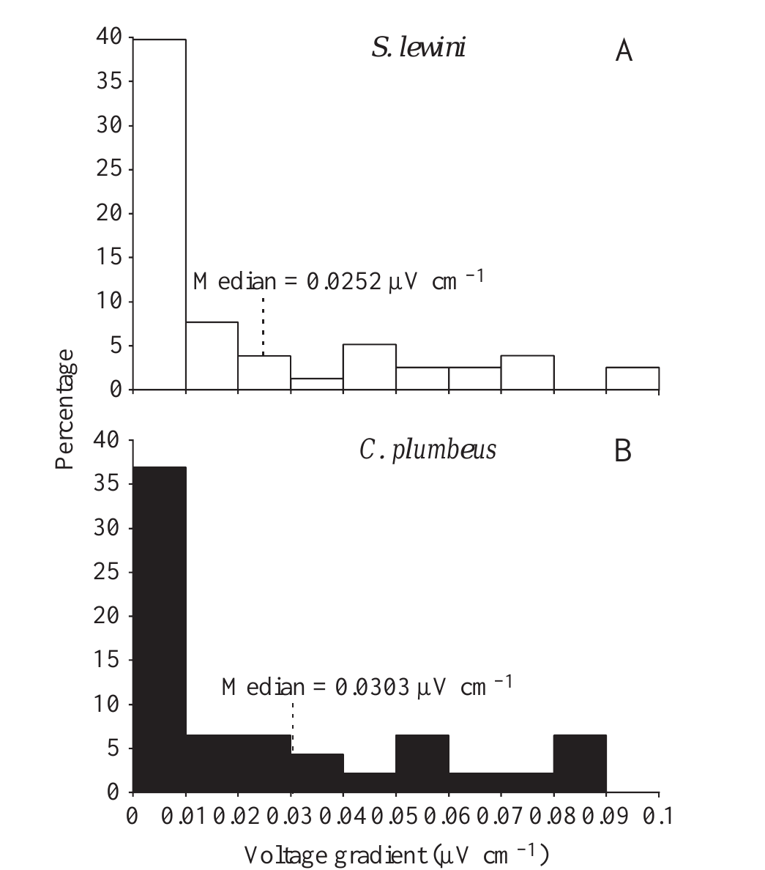
Feeding responses occur at nanovolt gradients
Kajiura and Holland converted measured encounter geometry into estimated field intensity at orientation onset. Both shark species initiated approximately 70% of orientations below 0.1 µV/cm, and approximately 35–40% below 0.01 µV/cm. Their most sensitive responses were below 1 nV/cm.
The 6.0-µA, 1-cm dipole and calibrated video provided the common reference for these estimates. Inactive outlets and current-switching trials constrained explanations involving visible target marks or electrode-associated cues. The distributions broadly overlapped despite the conspicuous difference in head morphology.
A behavioral threshold is defined by an observable response criterion; it is not necessarily the threshold of one sensory cell. The lowest measured responses depend on source modeling and motivation. Strong sensitivity is established, while exact comparisons with isolated-cell membrane voltages require additional physiological measurements.
Kajiura & Holland (2002), Fig. 8(A–B). Behavioral responses to fields below 0.1 µV/cm.
Kajiura & Holland (2002)
10
Notes:
• Kajiura and Holland converted measured encounter geometry into estimated field intensity at orientation onset. Both shark species initiated approximately 70% of orientations below 0.1 µV/cm, and approximately 35–40% below 0.01 µV/cm. Their most sensitive responses were below 1 nV/cm.
– The published histogram concentrates on encounters below 0.1 µV/cm because most responses occurred in this weak-field range. A field gradient expressed per centimeter cannot be equated directly with a voltage-clamp command expressed in millivolts. The two measures describe different levels of the sensory pathway.
• The 6.0-µA, 1-cm dipole and calibrated video provided the common reference for these estimates. Inactive outlets and current-switching trials constrained explanations involving visible target marks or electrode-associated cues. The distributions broadly overlapped despite the conspicuous difference in head morphology.
• A behavioral threshold is defined by an observable response criterion; it is not necessarily the threshold of one sensory cell. The lowest measured responses depend on source modeling and motivation. Strong sensitivity is established, while exact comparisons with isolated-cell membrane voltages require additional physiological measurements.
References:
Kajiura SM, Holland KN (2002). Electroreception in juvenile scalloped hammerhead and sandbar sharks. Journal of Experimental Biology 205(23):3609-3621. https://doi.org/10.1242/jeb.205.23.3609
Figure: Kajiura & Holland (2002), Fig. 8(A–B). Behavioral responses to fields below 0.1 µV/cm.
Figure source: https://doi.org/10.1242/jeb.205.23.3609

Slide 11
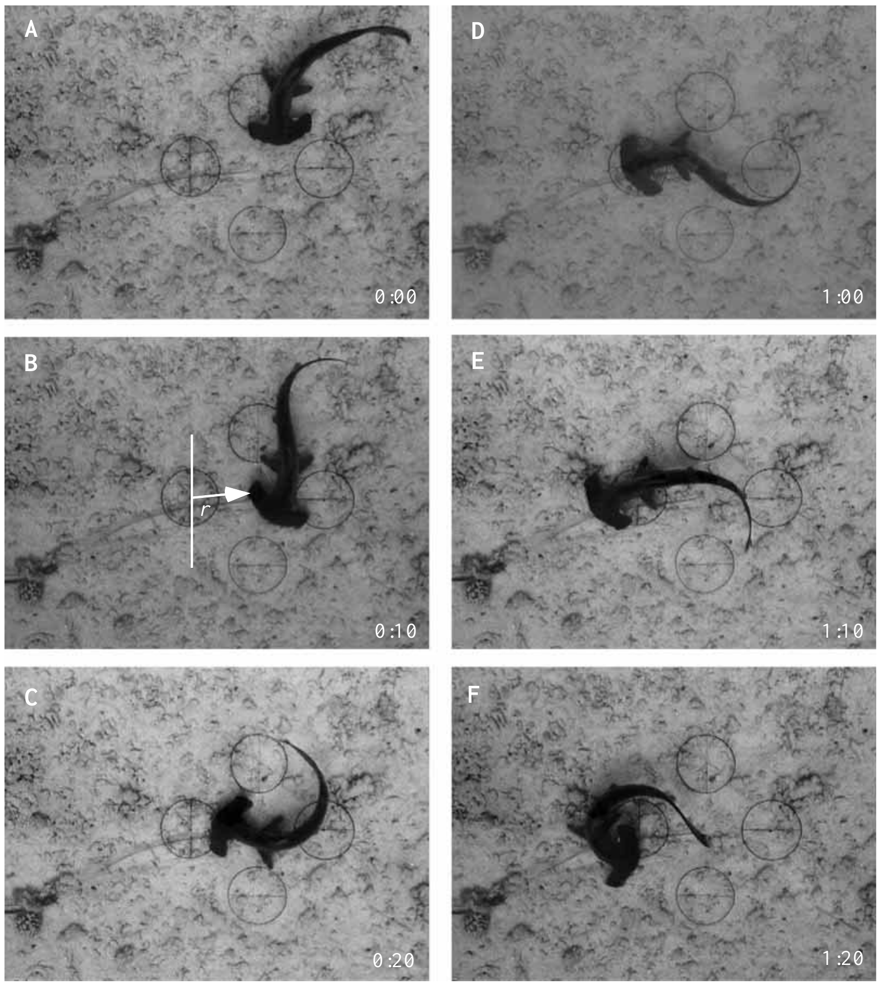
A broad head changes the mechanics of orientation
The cephalofoil is the laterally expanded head of a hammerhead shark. Video sequences recorded the position of the head while a scalloped hammerhead turned toward the active dipole. The head edge nearest the source could remain nearly stationary as the trunk pivoted around it.
Sandbar sharks generally followed broader arcs. Because the maximum orientation distances were similar, the different trajectories could not be attributed simply to earlier detection by hammerheads. Head shape and trunk flexibility changed how a detected electrical target was brought toward the mouth.
The cephalofoil also samples a wider lateral search area, potentially increasing encounters with sources beneath the animal. Improved search coverage and turning mechanics are distinct from greater receptor sensitivity. The proposed hydrodynamic explanation fits the observed trajectories but was not tested by directly manipulating head shape.
Kajiura & Holland (2002), Fig. 3(A–F). A hammerhead pivots toward an electric dipole.
Kajiura & Holland (2002)
11
Notes:
• The cephalofoil is the laterally expanded head of a hammerhead shark. Video sequences recorded the position of the head while a scalloped hammerhead turned toward the active dipole. The head edge nearest the source could remain nearly stationary as the trunk pivoted around it.
– The original photographs retain the temporal order of the approach and pivot. The investigators reconstructed paths from video instead of assuming that a straight approach followed field lines. Sensory detection and the motor maneuver that follows it can therefore vary independently between species.
• Sandbar sharks generally followed broader arcs. Because the maximum orientation distances were similar, the different trajectories could not be attributed simply to earlier detection by hammerheads. Head shape and trunk flexibility changed how a detected electrical target was brought toward the mouth.
• The cephalofoil also samples a wider lateral search area, potentially increasing encounters with sources beneath the animal. Improved search coverage and turning mechanics are distinct from greater receptor sensitivity. The proposed hydrodynamic explanation fits the observed trajectories but was not tested by directly manipulating head shape.
References:
Kajiura SM, Holland KN (2002). Electroreception in juvenile scalloped hammerhead and sandbar sharks. Journal of Experimental Biology 205(23):3609-3621. https://doi.org/10.1242/jeb.205.23.3609
Figure: Kajiura & Holland (2002), Fig. 3(A–F). A hammerhead pivots toward an electric dipole.
Figure source: https://doi.org/10.1242/jeb.205.23.3609

Slide 12
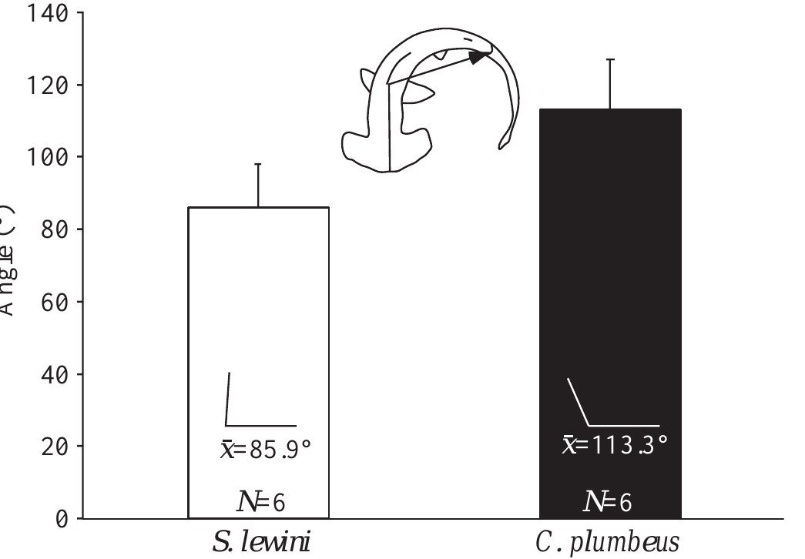
Body flexibility contributes to electrical prey capture
Kajiura and Holland quantified maximum trunk flexure during feeding turns. The mean measured angle was 85.9° in scalloped hammerheads and 113.3° in sandbars; the smaller angle represented a tighter bend. Body configuration was measured from video rather than inferred from the detection threshold.
The greater flexure of hammerheads was consistent with their rapid pivot orientations. Sandbars had broader trunks and typically used wider turning paths. The shared electrode apparatus distinguished these motor differences from differences in artificial-source spacing, current, or target availability.
Electroreception contributes to prey capture through a sensory-to-motor transformation, not merely by triggering a generic response. This study directly measured posture and trajectory, while the mechanical contribution of particular muscles or hydrodynamic forces remained an interpretation. Equal detection range can coexist with different interception performance.
Kajiura & Holland (2002), Fig. 10. Body flexure differs between shark species.
Kajiura & Holland (2002)
12
Notes:
• Kajiura and Holland quantified maximum trunk flexure during feeding turns. The mean measured angle was 85.9° in scalloped hammerheads and 113.3° in sandbars; the smaller angle represented a tighter bend. Body configuration was measured from video rather than inferred from the detection threshold.
– The angle metric describes the geometry of body bending, so its direction must be interpreted correctly: a smaller included angle corresponds to stronger flexure. The article did not record motor-neuron activity or manipulate muscular force. Those causal steps cannot be assigned solely from behavioral images.
• The greater flexure of hammerheads was consistent with their rapid pivot orientations. Sandbars had broader trunks and typically used wider turning paths. The shared electrode apparatus distinguished these motor differences from differences in artificial-source spacing, current, or target availability.
• Electroreception contributes to prey capture through a sensory-to-motor transformation, not merely by triggering a generic response. This study directly measured posture and trajectory, while the mechanical contribution of particular muscles or hydrodynamic forces remained an interpretation. Equal detection range can coexist with different interception performance.
References:
Kajiura SM, Holland KN (2002). Electroreception in juvenile scalloped hammerhead and sandbar sharks. Journal of Experimental Biology 205(23):3609-3621. https://doi.org/10.1242/jeb.205.23.3609
Figure: Kajiura & Holland (2002), Fig. 10. Body flexure differs between shark species.
Figure source: https://doi.org/10.1242/jeb.205.23.3609

Slide 13
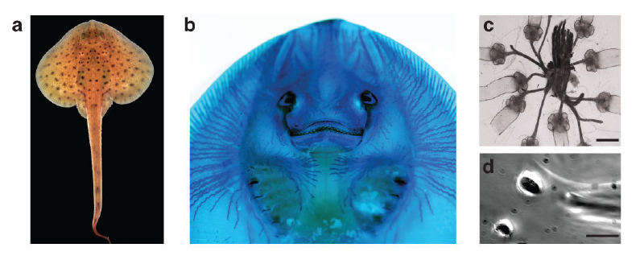
Skin pores connect to internal ampullary epithelia
The ampullae of Lorenzini are sensory organs in which skin pores connect through jelly-filled canals to an internal receptor epithelium. Bellono and colleagues examined the little skate, Leucoraja erinacea, using canal staining, organ dissection, and recordings from individual electrosensory cells.
Alcian Blue revealed the ventral canal network. Isolated ampullae retained short canal segments and attached afferent nerves, which carry sensory signals toward the brain; the published organ image has a 400-µm scale bar. Dissociated receptor cells were accessible to patch-clamp electrodes, with a 5-µm scale bar in the cellular preparation.
The pore samples external voltage. Receptor cells convert it into activity and synaptic output, transmission to sensory nerves through released chemicals called neurotransmitters. Canal anatomy explains access to an environmental signal but does not by itself identify the channel that amplifies it. Dissection allows mechanistic control while removing the intact animal’s spatial sampling.
Bellono et al. (2017), Fig. 1(a–d). Skate, canal network, isolated ampullae and receptor cell.
Bellono et al. (2017)
13
Notes:
• The ampullae of Lorenzini are sensory organs in which skin pores connect through jelly-filled canals to an internal receptor epithelium. Bellono and colleagues examined the little skate, Leucoraja erinacea, using canal staining, organ dissection, and recordings from individual electrosensory cells.
– The epithelium is a cellular sheet lining the sensory organ. Its lumen-facing surface and nerve-facing surface participate in different aspects of transduction and output. Maintaining an attached nerve in an organ preparation differs from dispersing cells for direct membrane-current measurements.
• Alcian Blue revealed the ventral canal network. Isolated ampullae retained short canal segments and attached afferent nerves, which carry sensory signals toward the brain; the published organ image has a 400-µm scale bar. Dissociated receptor cells were accessible to patch-clamp electrodes, with a 5-µm scale bar in the cellular preparation.
• The pore samples external voltage. Receptor cells convert it into activity and synaptic output, transmission to sensory nerves through released chemicals called neurotransmitters. Canal anatomy explains access to an environmental signal but does not by itself identify the channel that amplifies it. Dissection allows mechanistic control while removing the intact animal’s spatial sampling.
References:
Bellono NW, Leitch DB, Julius D (2017). Molecular basis of ancestral vertebrate electroreception. Nature 543(7645):391-396. https://doi.org/10.1038/nature21401
Figure: Bellono et al. (2017), Fig. 1(a–d). Skate, canal network, isolated ampullae and receptor cell.
Figure source: https://doi.org/10.1038/nature21401

Slide 14
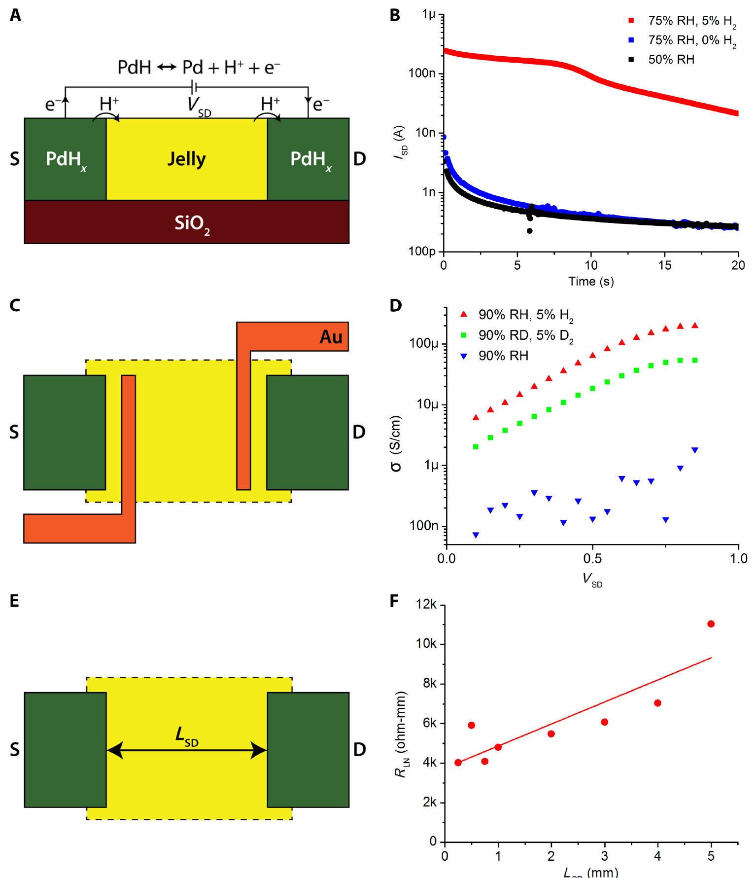
Ampullary jelly can conduct protons in vitro
Josberger and colleagues extracted ampullary jelly from sharks and skates and measured its electrical properties with controlled electrodes and humidity. A proton is a hydrogen ion, H⁺. Palladium-hydride contacts injected protons, whereas palladium contacts restricted their transfer into the sample.
At 75% relative humidity, a 1-V stimulus produced a proton-associated current peak near 250 nA, compared with approximately 10 nA for the ionic transient. Four-terminal measurements gave room-temperature proton conductivity near 2 mS/cm. Electrode comparisons separated charge-carrier behavior from a single undifferentiated current.
These are measurements of extracted material, not a direct recording of charge carriers traveling through a living canal during prey detection. The authors proposed that proton conduction may contribute to ampullary function. The intact organ’s physiological carrier balance and sensory advantage were not established by the material experiment.
Josberger et al. (2016), Fig. 2(A–F). Electrode controls and proton conductivity measurements.
Josberger et al. (2016)
14
Notes:
• Josberger and colleagues extracted ampullary jelly from sharks and skates and measured its electrical properties with controlled electrodes and humidity. A proton is a hydrogen ion, H⁺. Palladium-hydride contacts injected protons, whereas palladium contacts restricted their transfer into the sample.
– The jelly was hydrated before testing, and measurements controlled humidity because water content affects charge transport. A 1-V device stimulus is much larger than natural sensory signals. The preparation establishes a material property without identifying the receptor-cell mechanism or explaining a behavioral threshold.
• At 75% relative humidity, a 1-V stimulus produced a proton-associated current peak near 250 nA, compared with approximately 10 nA for the ionic transient. Four-terminal measurements gave room-temperature proton conductivity near 2 mS/cm. Electrode comparisons separated charge-carrier behavior from a single undifferentiated current.
• These are measurements of extracted material, not a direct recording of charge carriers traveling through a living canal during prey detection. The authors proposed that proton conduction may contribute to ampullary function. The intact organ’s physiological carrier balance and sensory advantage were not established by the material experiment.
References:
Josberger EE, Hassanzadeh P, Deng Y, Sohn J, Rego MJ, Amemiya CT, Rolandi M (2016). Proton conductivity in ampullae of Lorenzini jelly. Science Advances 2(5):e1600112. https://doi.org/10.1126/sciadv.1600112
Figure: Josberger et al. (2016), Fig. 2(A–F). Electrode controls and proton conductivity measurements.
Figure source: https://doi.org/10.1126/sciadv.1600112

Slide 15
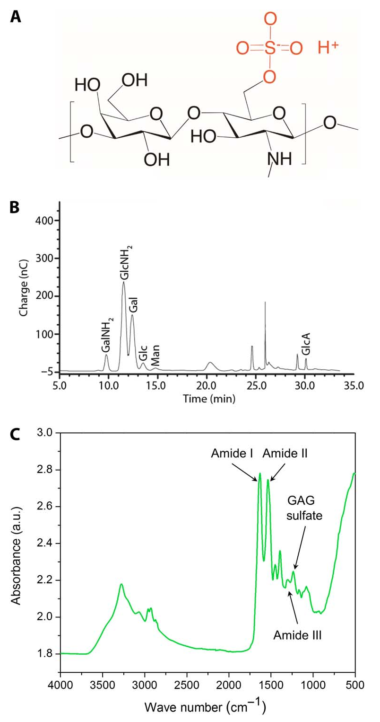
Jelly chemistry supports a conductive hydrogel
Josberger and colleagues characterized the jelly as a hydrogel, a hydrated polymer network. Prepared samples contained approximately 97% water. Drying reduced sample volume by about 80%, making hydration an essential experimental variable rather than a minor handling detail.
Chemical analyses identified sugars and sulfate-containing components consistent with keratan sulfate, a sulfated carbohydrate polymer. The original article combined compositional chromatography with infrared measurements. Sulfate groups could provide proton donors within a hydrated network, offering a possible material basis for measured proton conduction.
Chemical composition and electrical measurement support a conductive matrix, but they do not prove that keratan sulfate alone carries physiological sensory current. Species differences, hydration, electrode interfaces, and the intact canal remain relevant limitations. Material conduction must also be distinguished from membrane ion-channel amplification in receptor cells.
Josberger et al. (2016), Fig. 3(A–C). Chemical analyses of ampullary jelly.
Josberger et al. (2016)
15
Notes:
• Josberger and colleagues characterized the jelly as a hydrogel, a hydrated polymer network. Prepared samples contained approximately 97% water. Drying reduced sample volume by about 80%, making hydration an essential experimental variable rather than a minor handling detail.
– The authors treated the link between polymer chemistry and high proton conductivity as a proposed explanation. A constituent detected in extracted jelly need not be the only electrically relevant component. The results cannot establish a channel-mediated neuronal response because no living receptor epithelium was included.
• Chemical analyses identified sugars and sulfate-containing components consistent with keratan sulfate, a sulfated carbohydrate polymer. The original article combined compositional chromatography with infrared measurements. Sulfate groups could provide proton donors within a hydrated network, offering a possible material basis for measured proton conduction.
• Chemical composition and electrical measurement support a conductive matrix, but they do not prove that keratan sulfate alone carries physiological sensory current. Species differences, hydration, electrode interfaces, and the intact canal remain relevant limitations. Material conduction must also be distinguished from membrane ion-channel amplification in receptor cells.
References:
Josberger EE, Hassanzadeh P, Deng Y, Sohn J, Rego MJ, Amemiya CT, Rolandi M (2016). Proton conductivity in ampullae of Lorenzini jelly. Science Advances 2(5):e1600112. https://doi.org/10.1126/sciadv.1600112
Figure: Josberger et al. (2016), Fig. 3(A–C). Chemical analyses of ampullary jelly.
Figure source: https://doi.org/10.1126/sciadv.1600112

Slide 16
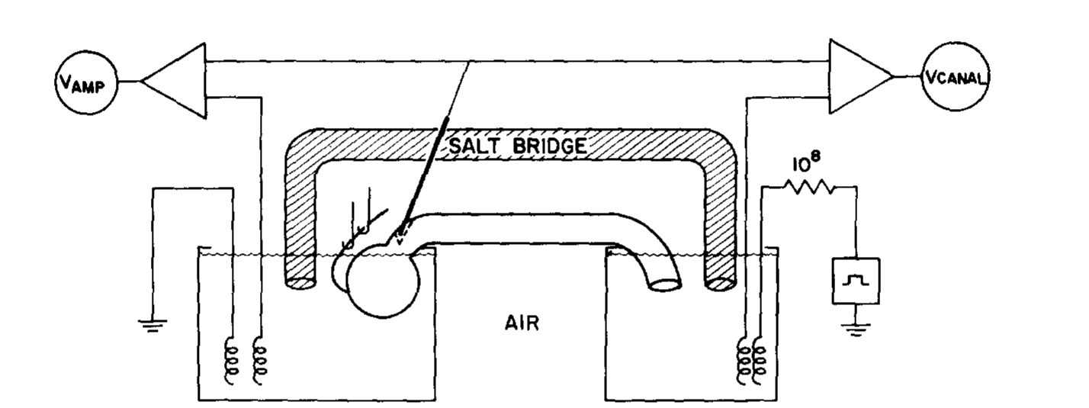
An isolated ampulla separates epithelial and nerve signals
Clusin and Bennett isolated skate ampullae with canals and afferent nerves attached. Separate saline compartments allowed current and voltage measurements across the receptor epithelium. A salt bridge shunted the canal, keeping transampullary voltage close to its resting operating range.
Current delivered between compartments imposed small voltage stimuli without requiring a freely swimming animal. The investigators simultaneously monitored epithelial current and postsynaptic, or receiving-side, nerve responses. Removing or restoring the shunt changed the electrical load, allowing spontaneous activity to be separated from stimulus-induced output.
This preparation links an external electrical perturbation to receptor-organ current and a neural response. It preserves a tissue-level circuit but cannot independently voltage-clamp every receptor cell or distinguish all apical and basal conductances. Later single-cell recordings provide complementary channel-level evidence rather than replacing this organ-level result.
Clusin & Bennett (1979), Fig. 1. Isolated ampulla, canal and recording compartments.
Clusin & Bennett (1979)
16
Notes:
• Clusin and Bennett isolated skate ampullae with canals and afferent nerves attached. Separate saline compartments allowed current and voltage measurements across the receptor epithelium. A salt bridge shunted the canal, keeping transampullary voltage close to its resting operating range.
– The canal’s resistance and the salt bridge influence how the imposed current produces a voltage across the epithelium. Recording nerve activity in a separate compartment prevents epithelial current from being mistaken for propagated afferent spikes. Electrical loading is therefore part of the experimental mechanism, not merely apparatus geometry.
• Current delivered between compartments imposed small voltage stimuli without requiring a freely swimming animal. The investigators simultaneously monitored epithelial current and postsynaptic, or receiving-side, nerve responses. Removing or restoring the shunt changed the electrical load, allowing spontaneous activity to be separated from stimulus-induced output.
• This preparation links an external electrical perturbation to receptor-organ current and a neural response. It preserves a tissue-level circuit but cannot independently voltage-clamp every receptor cell or distinguish all apical and basal conductances. Later single-cell recordings provide complementary channel-level evidence rather than replacing this organ-level result.
References:
Clusin WT, Bennett MVL (1979). The oscillatory responses of skate electroreceptors to small voltage stimuli. Journal of General Physiology 73(6):685-702. https://doi.org/10.1085/jgp.73.6.685
Figure: Clusin & Bennett (1979), Fig. 1. Isolated ampulla, canal and recording compartments.
Figure source: https://doi.org/10.1085/jgp.73.6.685

Slide 17
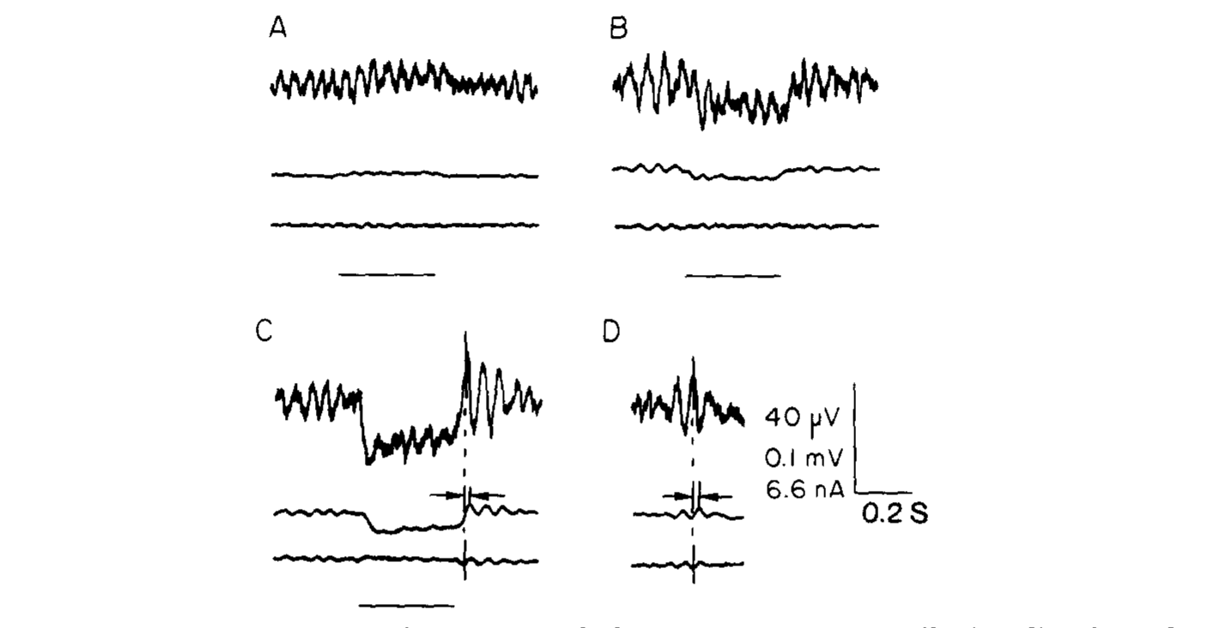
Stimulus polarity changes synaptic drive to afferents
Clusin and Bennett applied small voltage steps to a shunted skate ampulla. A lumen-negative stimulus of 5 µV depolarized the postsynaptic nerve, whereas a lumen-positive stimulus of 10 µV hyperpolarized it. Depolarization makes membrane voltage less negative; hyperpolarization makes it more negative.
Tetrodotoxin at 0.1 µM abolished postsynaptic action potentials so the underlying synaptic response could be measured. Small stimuli changed nerve potential without a comparably large change in total epithelial current. The same organ therefore transmitted changes much smaller than ordinary cellular membrane-voltage excursions.
Opposite response signs constrain how the receptor converts an environmental voltage into afferent drive. Tetrodotoxin separates sodium-dependent spikes from the preceding synaptic potential; it does not identify the released neurotransmitter or its postsynaptic receptor. Those molecular identities should not be inferred from response polarity alone.
Clusin & Bennett (1979), Fig. 3(A–D). Opposite stimulus polarities alter postsynaptic potential.
Clusin & Bennett (1979)
17
Notes:
• Clusin and Bennett applied small voltage steps to a shunted skate ampulla. A lumen-negative stimulus of 5 µV depolarized the postsynaptic nerve, whereas a lumen-positive stimulus of 10 µV hyperpolarized it. Depolarization makes membrane voltage less negative; hyperpolarization makes it more negative.
– The stimulus sign refers to the ampullary lumen relative to the external compartment. It is not interchangeable with the polarity of an electrode source in an arbitrary swimming orientation. The experiment preserved simultaneous epithelial and neural recordings, giving two distinct measures of the same perturbation.
• Tetrodotoxin at 0.1 µM abolished postsynaptic action potentials so the underlying synaptic response could be measured. Small stimuli changed nerve potential without a comparably large change in total epithelial current. The same organ therefore transmitted changes much smaller than ordinary cellular membrane-voltage excursions.
• Opposite response signs constrain how the receptor converts an environmental voltage into afferent drive. Tetrodotoxin separates sodium-dependent spikes from the preceding synaptic potential; it does not identify the released neurotransmitter or its postsynaptic receptor. Those molecular identities should not be inferred from response polarity alone.
References:
Clusin WT, Bennett MVL (1979). The oscillatory responses of skate electroreceptors to small voltage stimuli. Journal of General Physiology 73(6):685-702. https://doi.org/10.1085/jgp.73.6.685
Figure: Clusin & Bennett (1979), Fig. 3(A–D). Opposite stimulus polarities alter postsynaptic potential.
Figure source: https://doi.org/10.1085/jgp.73.6.685

Slide 18
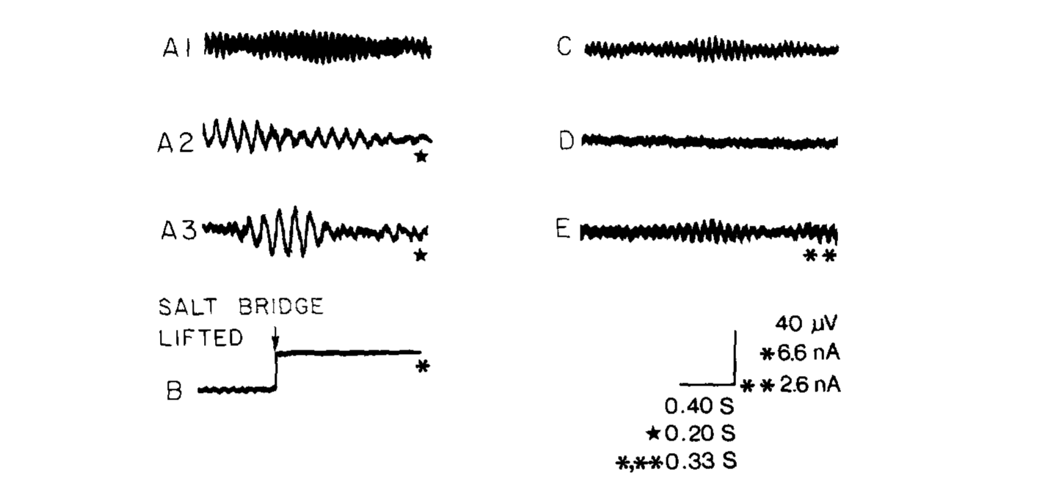
The receptor epithelium generates spontaneous oscillations
A membrane oscillation is a repeated fluctuation in electrical activity. Clusin and Bennett recorded small spontaneous currents in shunted skate ampullae. Their frequency lay approximately between 1 and 8 Hz under the reported conditions, even without a deliberately applied sensory stimulus.
Lifting the salt bridge interrupted canal current and exposed the organ’s steady receptor current. Comparing the shunted and unshunted conditions separated the small oscillatory component from the larger tonic current. The observations established endogenous epithelial activity rather than motion-induced electrical fluctuations in a swimming animal.
Oscillations provide a time-varying presynaptic state upon which weak signals can act. Their presence does not alone specify which membrane or channel generates them, and intact epithelial measurements combine many cells. Later molecular experiments directly tested calcium and potassium currents that could produce this activity in single receptor cells.
Clusin & Bennett (1979), Fig. 2(A1–A3, B–E). Spontaneous epithelial currents and oscillations.
Clusin & Bennett (1979)
18
Notes:
• A membrane oscillation is a repeated fluctuation in electrical activity. Clusin and Bennett recorded small spontaneous currents in shunted skate ampullae. Their frequency lay approximately between 1 and 8 Hz under the reported conditions, even without a deliberately applied sensory stimulus.
– A tonic current persists without periodic stimulation, whereas an oscillatory current repeatedly changes around its operating point. The receptor organ exhibited both. Altering the canal shunt also altered its electrical loading, so these records cannot be treated as unmodified measurements of a freely behaving skate.
• Lifting the salt bridge interrupted canal current and exposed the organ’s steady receptor current. Comparing the shunted and unshunted conditions separated the small oscillatory component from the larger tonic current. The observations established endogenous epithelial activity rather than motion-induced electrical fluctuations in a swimming animal.
• Oscillations provide a time-varying presynaptic state upon which weak signals can act. Their presence does not alone specify which membrane or channel generates them, and intact epithelial measurements combine many cells. Later molecular experiments directly tested calcium and potassium currents that could produce this activity in single receptor cells.
References:
Clusin WT, Bennett MVL (1979). The oscillatory responses of skate electroreceptors to small voltage stimuli. Journal of General Physiology 73(6):685-702. https://doi.org/10.1085/jgp.73.6.685
Figure: Clusin & Bennett (1979), Fig. 2(A1–A3, B–E). Spontaneous epithelial currents and oscillations.
Figure source: https://doi.org/10.1085/jgp.73.6.685

Slide 19
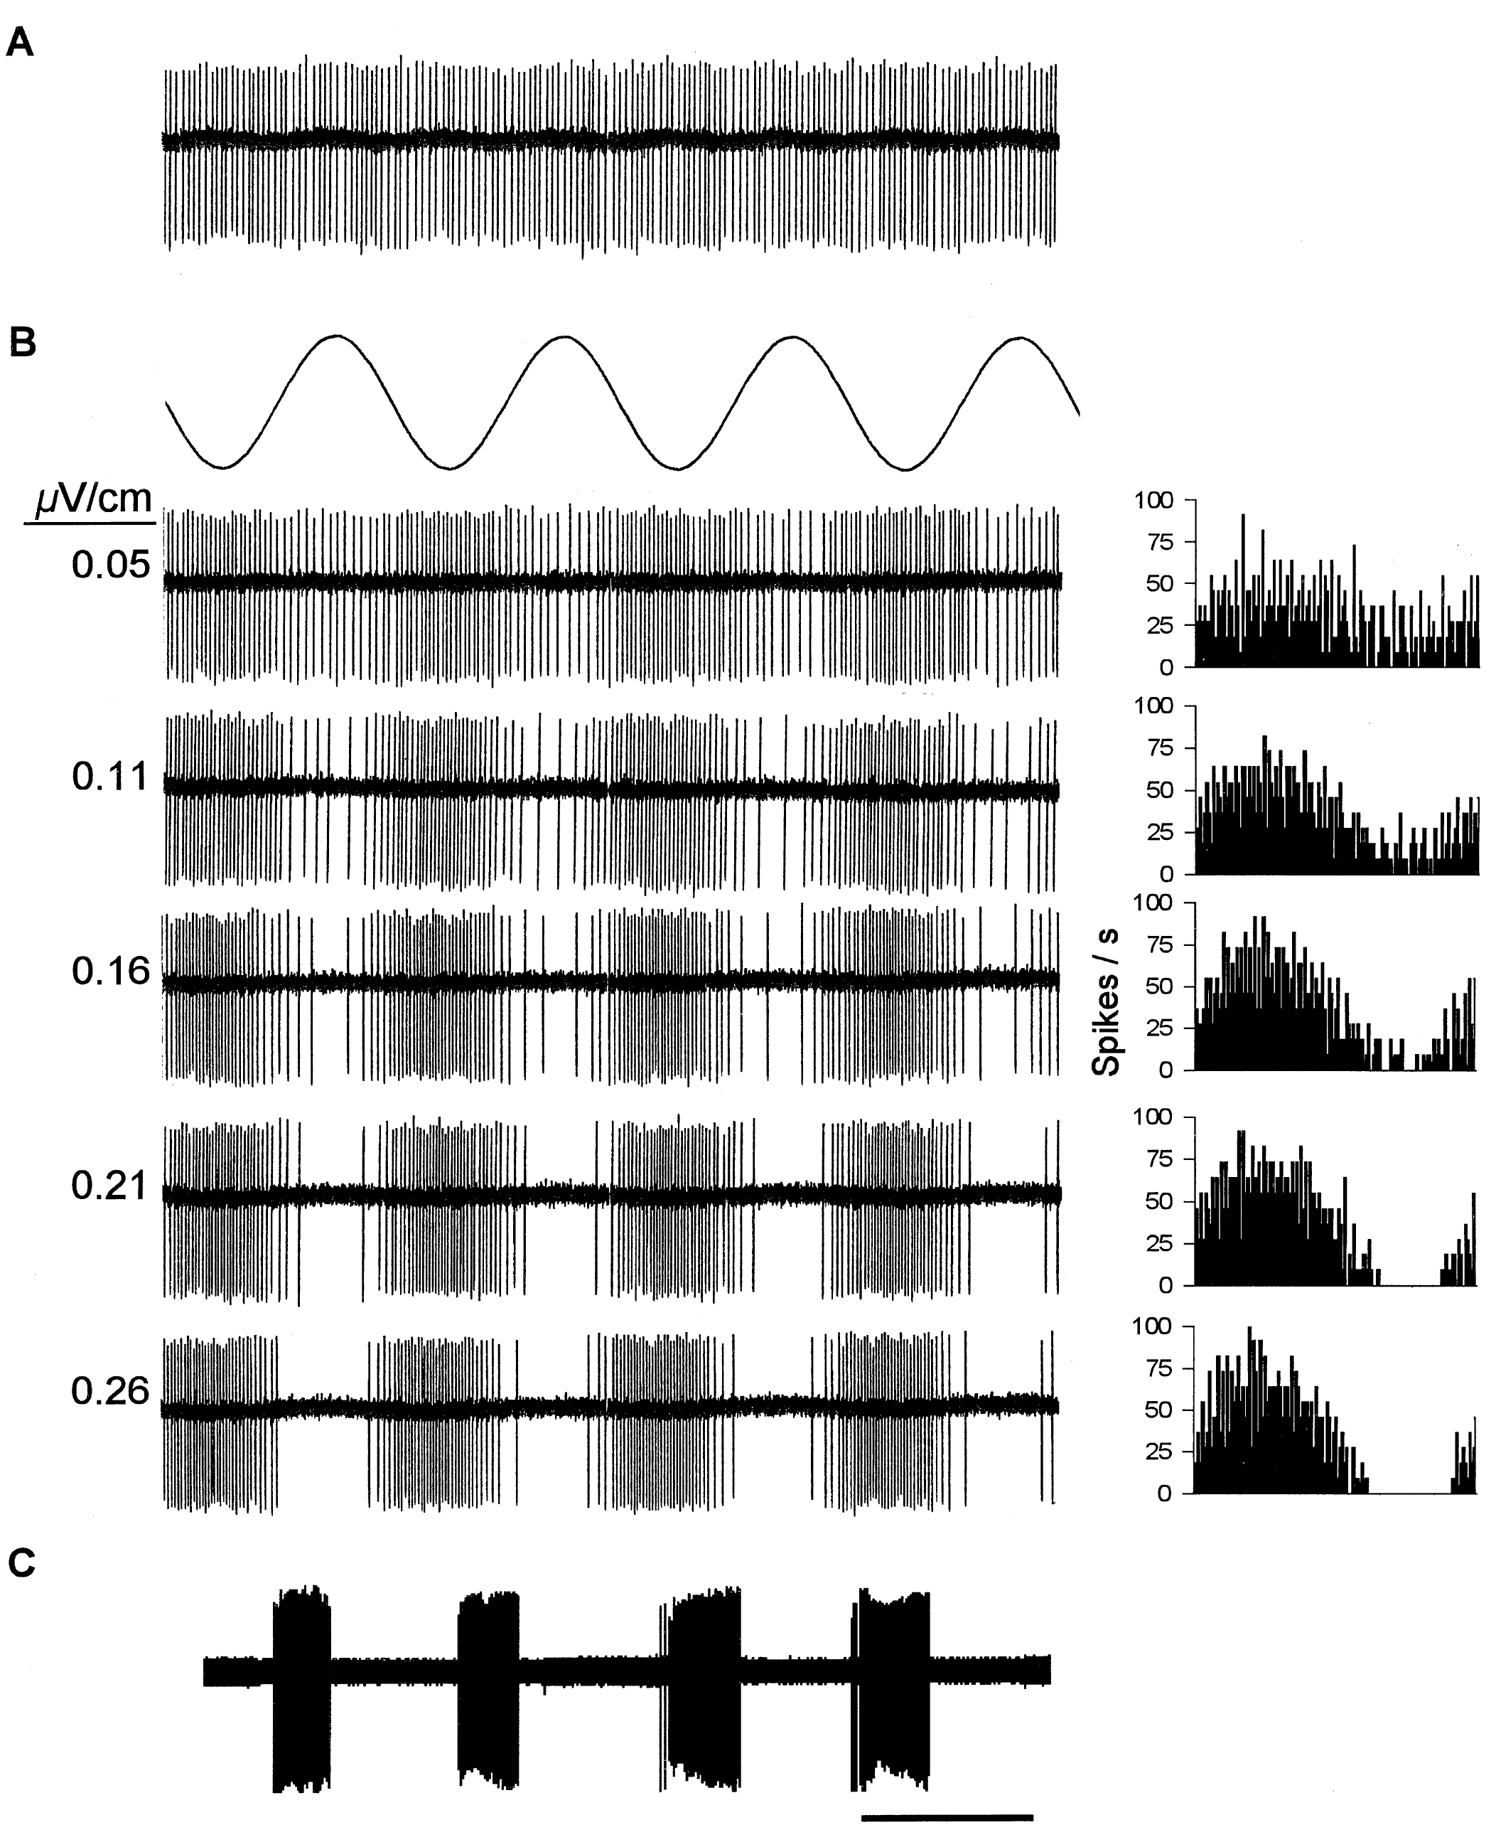
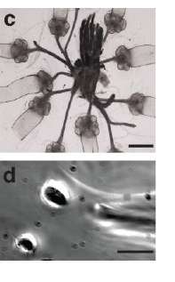
Afferent spikes encode electric-field phase
A primary afferent is a sensory neuron carrying receptor output toward the central nervous system. Tricas and New recorded these neurons in immobilized round stingrays, Urolophus halleri, while uniform electric fields were applied across the body and artificial ventilation maintained respiration.
A 1-Hz sinusoid modulated a regular resting spike train. Increasing peak-to-peak field intensity from 0.05 to 0.26 µV/cm increased firing during one phase and progressively silenced the neuron during the opposite phase. Period histograms aligned spikes to the recurring stimulus cycle.
Phase-dependent increases and decreases carry directional electrical information relative to spontaneous activity. At stronger stimulation, pauses can become complete even while firing during the excitatory phase remains high. Afferent output is therefore a temporally structured spike train, not simply a binary indication that an electric source exists.
Tricas & New (1998), Fig. 2(A–C). Resting firing and phase-dependent afferent modulation.
Bellono et al. (2017), Fig. 1(c–d). Isolated ampulla and receptor cell.
Tricas & New (1998); Bellono et al. (2017)
19
Notes:
• A primary afferent is a sensory neuron carrying receptor output toward the central nervous system. Tricas and New recorded these neurons in immobilized round stingrays, Urolophus halleri, while uniform electric fields were applied across the body and artificial ventilation maintained respiration.
– The investigators cut sensory and motor branches that would otherwise permit bodily movements to contaminate the applied field. The uniform stimulus controlled field direction, but lacked the spatial complexity of an actual prey dipole. A primary nerve recording also includes receptor and synaptic processing before spikes are observed.
• A 1-Hz sinusoid modulated a regular resting spike train. Increasing peak-to-peak field intensity from 0.05 to 0.26 µV/cm increased firing during one phase and progressively silenced the neuron during the opposite phase. Period histograms aligned spikes to the recurring stimulus cycle.
• Phase-dependent increases and decreases carry directional electrical information relative to spontaneous activity. At stronger stimulation, pauses can become complete even while firing during the excitatory phase remains high. Afferent output is therefore a temporally structured spike train, not simply a binary indication that an electric source exists.
References:
Tricas TC, New JG (1998). Sensitivity and response dynamics of elasmobranch electrosensory primary afferent neurons to near threshold fields. Journal of Comparative Physiology A: Sensory, Neural, and Behavioral Physiology 182(1):89-101. https://doi.org/10.1007/s003590050161
Bellono NW, Leitch DB, Julius D (2017). Molecular basis of ancestral vertebrate electroreception. Nature 543(7645):391-396. https://doi.org/10.1038/nature21401
Figure: Tricas & New (1998), Fig. 2(A–C). Resting firing and phase-dependent afferent modulation.
Figure source: https://doi.org/10.1007/s003590050161
Figure: Bellono et al. (2017), Fig. 1(c–d). Isolated ampulla and receptor cell.
Figure source: https://doi.org/10.1038/nature21401

Slide 20
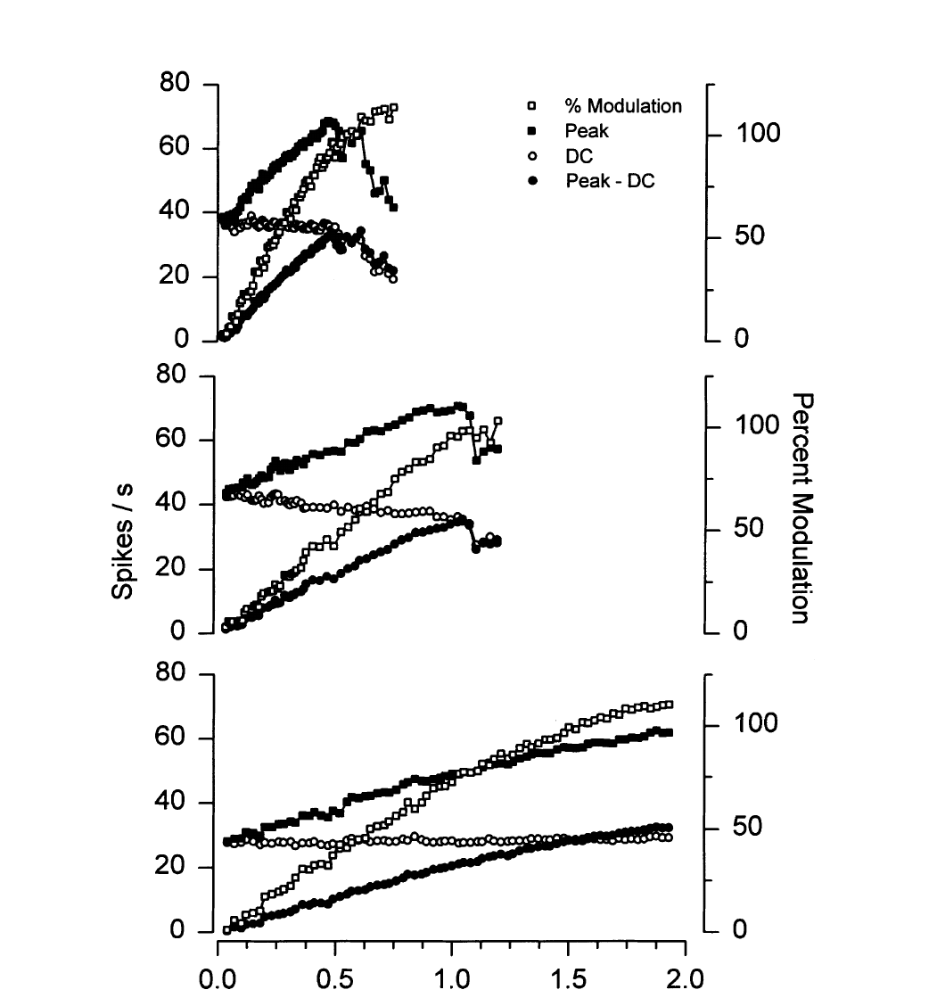
Near-threshold afferents have different response gains
Gain describes how strongly a neural response changes for a change in stimulus intensity. Tricas and New measured peak firing and resting firing while increasing a 1-Hz electric field. Different afferents had markedly different rate–intensity relationships under the same general preparation.
A high-gain example reached strong modulation near 0.5 µV/cm, while lower-gain units required larger gradients. The most sensitive afferents encoded peak gradients of approximately 20 nV/cm or less. Measuring the field rather than source current allowed neural sensitivity to be related to the local applied stimulus.
Higher sensitivity at weak fields does not imply unlimited encoding of stronger inputs. An afferent can reach a saturated response before another neuron becomes strongly modulated. Population diversity could therefore support detection and intensity representation over different ranges, although the study did not directly test the downstream population decoder.
Tricas & New (1998), Fig. 5. Rate–intensity curves span distinct afferent gains.
Bellono et al. (2017), Fig. 1(c–d). Isolated ampulla and receptor cell.
Tricas & New (1998); Bellono et al. (2017)
20
Notes:
• Gain describes how strongly a neural response changes for a change in stimulus intensity. Tricas and New measured peak firing and resting firing while increasing a 1-Hz electric field. Different afferents had markedly different rate–intensity relationships under the same general preparation.
– Peak firing above the spontaneous rate and total peak firing are different quantities. Subtracting baseline isolates modulation, while the absolute spike rate indicates how much activity reaches the brain. The authors emphasized weak-field measurements because strong stimuli can conceal this variation through saturation.
• A high-gain example reached strong modulation near 0.5 µV/cm, while lower-gain units required larger gradients. The most sensitive afferents encoded peak gradients of approximately 20 nV/cm or less. Measuring the field rather than source current allowed neural sensitivity to be related to the local applied stimulus.
• Higher sensitivity at weak fields does not imply unlimited encoding of stronger inputs. An afferent can reach a saturated response before another neuron becomes strongly modulated. Population diversity could therefore support detection and intensity representation over different ranges, although the study did not directly test the downstream population decoder.
References:
Tricas TC, New JG (1998). Sensitivity and response dynamics of elasmobranch electrosensory primary afferent neurons to near threshold fields. Journal of Comparative Physiology A: Sensory, Neural, and Behavioral Physiology 182(1):89-101. https://doi.org/10.1007/s003590050161
Bellono NW, Leitch DB, Julius D (2017). Molecular basis of ancestral vertebrate electroreception. Nature 543(7645):391-396. https://doi.org/10.1038/nature21401
Figure: Tricas & New (1998), Fig. 5. Rate–intensity curves span distinct afferent gains.
Figure source: https://doi.org/10.1007/s003590050161
Figure: Bellono et al. (2017), Fig. 1(c–d). Isolated ampulla and receptor cell.
Figure source: https://doi.org/10.1038/nature21401

Slide 21
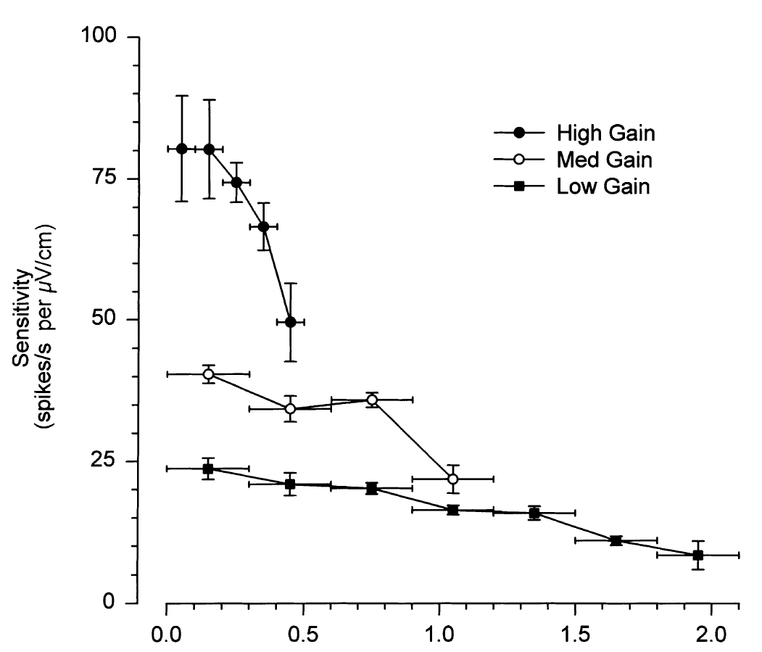
Saturation limits rate-based intensity encoding
Tricas and New calculated local slopes of each rate–intensity curve across successive stimulus intervals. The most sensitive example maintained a steep response only over the weakest range, then lost incremental gain as field intensity increased. Lower-gain afferents declined over different operating ranges.
For many units, peak-rate intensity encoding was lost below 1 µV/cm when peak firing roughly doubled resting discharge. Inhibitory phases were also clipped at zero spikes. A physical increase in the electric field therefore did not guarantee a proportional increase in the neuron’s available rate modulation.
Saturation means that a response approaches a limit despite continued stimulus increase. It constrains what one afferent can report about source strength, but need not abolish all temporal information or population information. The study measured single-unit encoding; it did not establish the limits of behavioral intensity discrimination.
Tricas & New (1998), Fig. 6. Incremental sensitivity falls as stimulus strength increases.
Bellono et al. (2017), Fig. 1(c–d). Isolated ampulla and receptor cell.
Tricas & New (1998); Bellono et al. (2017)
21
Notes:
• Tricas and New calculated local slopes of each rate–intensity curve across successive stimulus intervals. The most sensitive example maintained a steep response only over the weakest range, then lost incremental gain as field intensity increased. Lower-gain afferents declined over different operating ranges.
– The analysis used successive portions of a measured response curve rather than assuming one linear gain for its full extent. A neuron’s weak-field slope can consequently overestimate its sensitivity to stronger fields. This distinction matters when comparing thresholds from experiments using very different stimulus amplitudes.
• For many units, peak-rate intensity encoding was lost below 1 µV/cm when peak firing roughly doubled resting discharge. Inhibitory phases were also clipped at zero spikes. A physical increase in the electric field therefore did not guarantee a proportional increase in the neuron’s available rate modulation.
• Saturation means that a response approaches a limit despite continued stimulus increase. It constrains what one afferent can report about source strength, but need not abolish all temporal information or population information. The study measured single-unit encoding; it did not establish the limits of behavioral intensity discrimination.
References:
Tricas TC, New JG (1998). Sensitivity and response dynamics of elasmobranch electrosensory primary afferent neurons to near threshold fields. Journal of Comparative Physiology A: Sensory, Neural, and Behavioral Physiology 182(1):89-101. https://doi.org/10.1007/s003590050161
Bellono NW, Leitch DB, Julius D (2017). Molecular basis of ancestral vertebrate electroreception. Nature 543(7645):391-396. https://doi.org/10.1038/nature21401
Figure: Tricas & New (1998), Fig. 6. Incremental sensitivity falls as stimulus strength increases.
Figure source: https://doi.org/10.1007/s003590050161
Figure: Bellono et al. (2017), Fig. 1(c–d). Isolated ampulla and receptor cell.
Figure source: https://doi.org/10.1038/nature21401

Slide 22
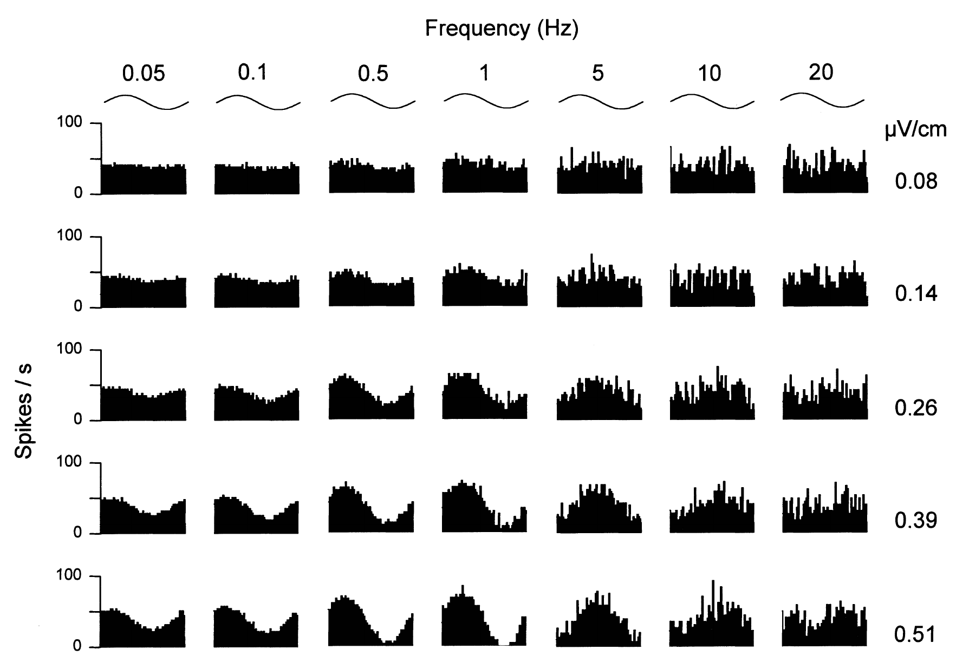
Frequency and intensity interact in afferent responses
Tricas and New varied both sinusoidal frequency and field intensity for individual round-stingray afferents. A period histogram groups spikes by their position within one stimulus cycle. It separates changes in temporal locking from a change in overall spontaneous discharge.
The published response matrix includes frequencies from 0.05 to 20 Hz and fields from 0.08 to 0.51 µV/cm. A representative unit was most sensitive near 1 Hz: approximately 0.08 µV/cm produced weak modulation, whereas around 0.4 µV/cm produced full modulation.
Frequency selectivity therefore depends on the response range used to measure it. Strong signals can saturate firing at favorable frequencies and conceal differences that are evident near threshold. These recordings connect receptor output to slow natural electrical fluctuations but do not directly measure behavioral discrimination between prey-generated waveforms.
Tricas & New (1998), Fig. 7. Frequency and amplitude jointly determine afferent discharge.
Bellono et al. (2017), Fig. 1(c–d). Isolated ampulla and receptor cell.
Tricas & New (1998); Bellono et al. (2017)
22
Notes:
• Tricas and New varied both sinusoidal frequency and field intensity for individual round-stingray afferents. A period histogram groups spikes by their position within one stimulus cycle. It separates changes in temporal locking from a change in overall spontaneous discharge.
– At high frequencies the same amplitude could elicit much less modulation than near the best frequency. A best frequency is the stimulus rate yielding the strongest response under a specified condition, not a preferred acoustic tone. The tested input was an electric field changing over time.
• The published response matrix includes frequencies from 0.05 to 20 Hz and fields from 0.08 to 0.51 µV/cm. A representative unit was most sensitive near 1 Hz: approximately 0.08 µV/cm produced weak modulation, whereas around 0.4 µV/cm produced full modulation.
• Frequency selectivity therefore depends on the response range used to measure it. Strong signals can saturate firing at favorable frequencies and conceal differences that are evident near threshold. These recordings connect receptor output to slow natural electrical fluctuations but do not directly measure behavioral discrimination between prey-generated waveforms.
References:
Tricas TC, New JG (1998). Sensitivity and response dynamics of elasmobranch electrosensory primary afferent neurons to near threshold fields. Journal of Comparative Physiology A: Sensory, Neural, and Behavioral Physiology 182(1):89-101. https://doi.org/10.1007/s003590050161
Bellono NW, Leitch DB, Julius D (2017). Molecular basis of ancestral vertebrate electroreception. Nature 543(7645):391-396. https://doi.org/10.1038/nature21401
Figure: Tricas & New (1998), Fig. 7. Frequency and amplitude jointly determine afferent discharge.
Figure source: https://doi.org/10.1007/s003590050161
Figure: Bellono et al. (2017), Fig. 1(c–d). Isolated ampulla and receptor cell.
Figure source: https://doi.org/10.1038/nature21401

Slide 23
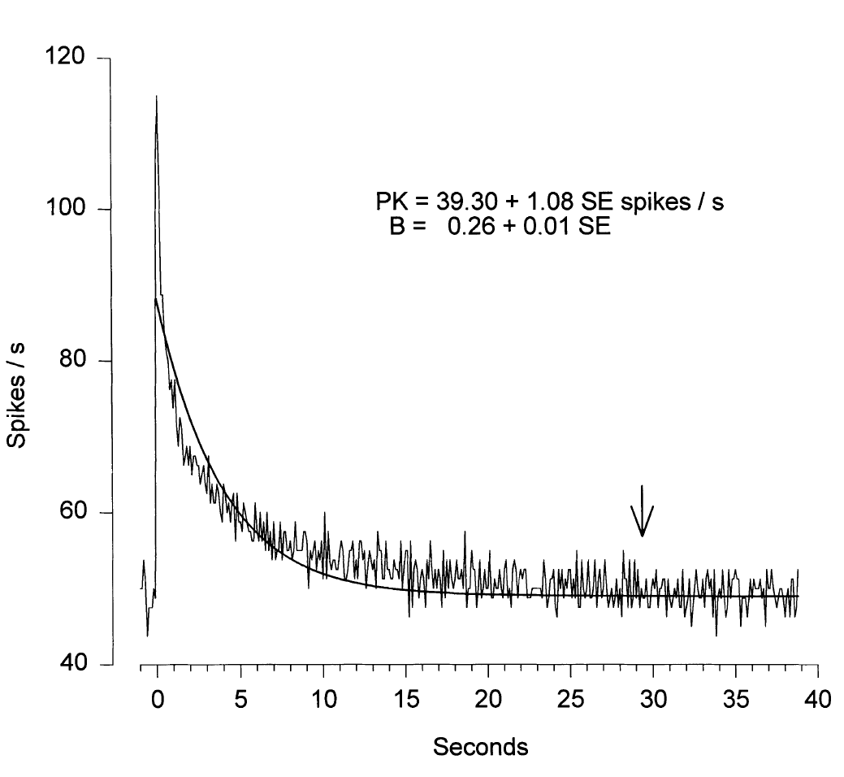
Sustained fields evoke adapting neural responses
Adaptation is a decline in response during maintained stimulation. Tricas and New applied direct-current field steps lasting 60 s to round-stingray afferents. A representative 2.2-µV/cm step caused a large initial increase in spike rate followed by a return toward the resting rate.
The measured decay had a time constant of approximately 4 s. Repeating steps allowed the response time course to be averaged without relying on a single spike train. The maintained physical input therefore differed from the transient information conveyed by the afferent output.
An adapting system can still detect a spatially stationary prey source because swimming changes the electrical input sampled at the pores. The physiological finding is the step-response decline; applying it to natural movement is an interpretation about stimulus sampling. The experiment did not track receptor signals during an unconstrained hunting trajectory.
Tricas & New (1998), Fig. 9. Response to a sustained field adapts over seconds.
Bellono et al. (2017), Fig. 1(c–d). Isolated ampulla and receptor cell.
Tricas & New (1998); Bellono et al. (2017)
23
Notes:
• Adaptation is a decline in response during maintained stimulation. Tricas and New applied direct-current field steps lasting 60 s to round-stingray afferents. A representative 2.2-µV/cm step caused a large initial increase in spike rate followed by a return toward the resting rate.
– A time constant describes how rapidly the measured response approaches its adapted level. It does not mean that the stimulus lasted only four seconds or that all afferents adapt identically. The 60-second step was deliberately long enough to separate the initial response from sustained output.
• The measured decay had a time constant of approximately 4 s. Repeating steps allowed the response time course to be averaged without relying on a single spike train. The maintained physical input therefore differed from the transient information conveyed by the afferent output.
• An adapting system can still detect a spatially stationary prey source because swimming changes the electrical input sampled at the pores. The physiological finding is the step-response decline; applying it to natural movement is an interpretation about stimulus sampling. The experiment did not track receptor signals during an unconstrained hunting trajectory.
References:
Tricas TC, New JG (1998). Sensitivity and response dynamics of elasmobranch electrosensory primary afferent neurons to near threshold fields. Journal of Comparative Physiology A: Sensory, Neural, and Behavioral Physiology 182(1):89-101. https://doi.org/10.1007/s003590050161
Bellono NW, Leitch DB, Julius D (2017). Molecular basis of ancestral vertebrate electroreception. Nature 543(7645):391-396. https://doi.org/10.1038/nature21401
Figure: Tricas & New (1998), Fig. 9. Response to a sustained field adapts over seconds.
Figure source: https://doi.org/10.1007/s003590050161
Figure: Bellono et al. (2017), Fig. 1(c–d). Isolated ampulla and receptor cell.
Figure source: https://doi.org/10.1038/nature21401

Slide 24
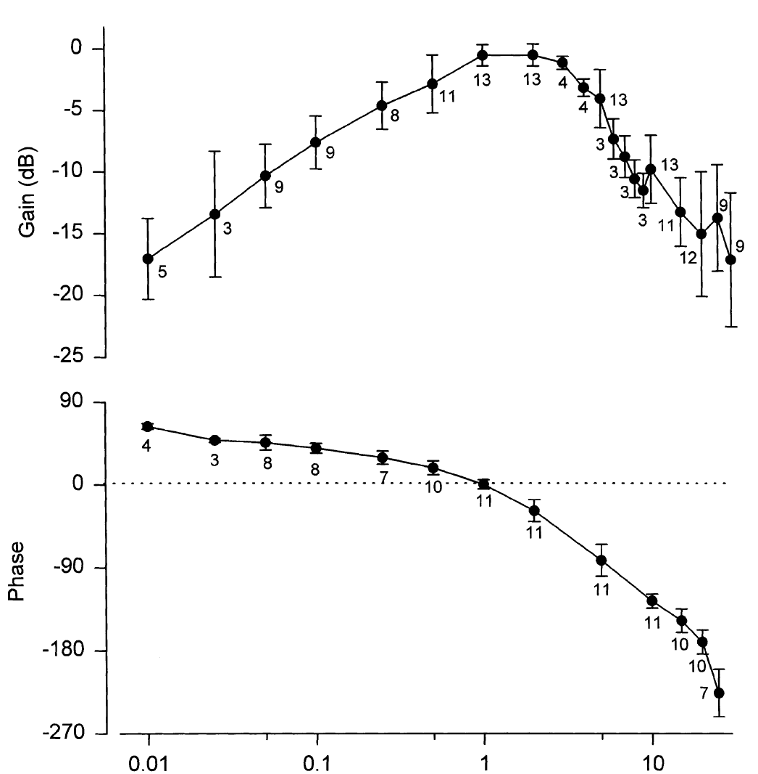
Round-stingray afferents favor slow field changes
Tricas and New measured response gain across sinusoidal electric-field frequencies while keeping stimulation weak enough to limit saturation. Nearly all tested round-stingray afferents had their best sensitivity at approximately 1–2 Hz. Responses fell at frequencies both below and above this range.
The normalized frequency response declined by 3 dB near 0.5 Hz and 4 Hz. Its low-frequency slope was approximately 8 dB per decade, and its high-frequency slope approximately −23 dB per decade. Normalizing each unit to its own maximum separated tuning shape from differences in absolute gain.
This band-pass tuning favors changes over a limited frequency range rather than either constant fields or arbitrarily rapid fluctuations. Slow prey and conspecific ventilation can supply relevant inputs. The recordings establish afferent tuning in this species; they do not prove an identical frequency optimum for all sharks, rays, or behaviors.
Tricas & New (1998), Fig. 10. Frequency-dependent gain and phase of primary afferents.
Bellono et al. (2017), Fig. 1(c–d). Isolated ampulla and receptor cell.
Tricas & New (1998); Bellono et al. (2017)
24
Notes:
• Tricas and New measured response gain across sinusoidal electric-field frequencies while keeping stimulation weak enough to limit saturation. Nearly all tested round-stingray afferents had their best sensitivity at approximately 1–2 Hz. Responses fell at frequencies both below and above this range.
– A phase plot measures whether peak neural activity occurs before, with, or after a particular phase of the applied sinusoid. The representative population response was approximately in phase near 1 Hz. Frequency-dependent phase and gain together describe how an afferent transforms a changing field.
• The normalized frequency response declined by 3 dB near 0.5 Hz and 4 Hz. Its low-frequency slope was approximately 8 dB per decade, and its high-frequency slope approximately −23 dB per decade. Normalizing each unit to its own maximum separated tuning shape from differences in absolute gain.
• This band-pass tuning favors changes over a limited frequency range rather than either constant fields or arbitrarily rapid fluctuations. Slow prey and conspecific ventilation can supply relevant inputs. The recordings establish afferent tuning in this species; they do not prove an identical frequency optimum for all sharks, rays, or behaviors.
References:
Tricas TC, New JG (1998). Sensitivity and response dynamics of elasmobranch electrosensory primary afferent neurons to near threshold fields. Journal of Comparative Physiology A: Sensory, Neural, and Behavioral Physiology 182(1):89-101. https://doi.org/10.1007/s003590050161
Bellono NW, Leitch DB, Julius D (2017). Molecular basis of ancestral vertebrate electroreception. Nature 543(7645):391-396. https://doi.org/10.1038/nature21401
Figure: Tricas & New (1998), Fig. 10. Frequency-dependent gain and phase of primary afferents.
Figure source: https://doi.org/10.1007/s003590050161
Figure: Bellono et al. (2017), Fig. 1(c–d). Isolated ampulla and receptor cell.
Figure source: https://doi.org/10.1038/nature21401

Slide 25
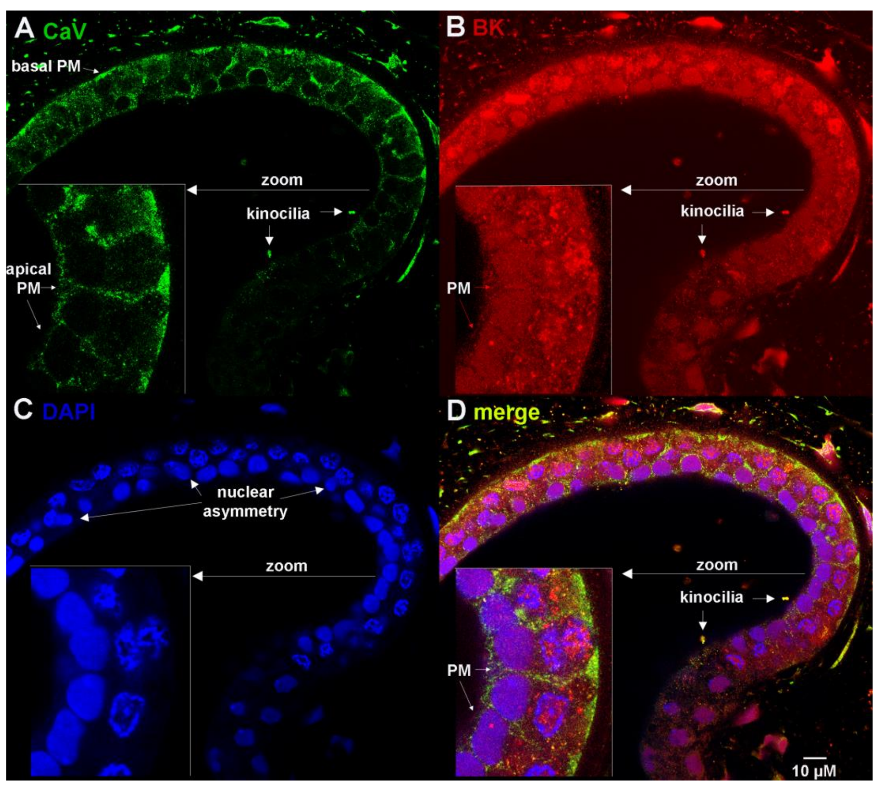
Channel proteins occupy specific receptor compartments
Chen and colleagues used whole-mount confocal microscopy to localize channel proteins in intact little-skate ampullae. CaV1.3 is a voltage-gated calcium channel; BK is a calcium-activated potassium channel. Antibody staining was combined with DAPI, a fluorescent label for nuclear DNA.
CaV1.3 and BK immunoreactivity occurred in receptor plasma membranes, nuclear envelopes, and kinocilia, the ciliary projections facing the lumen. Overlapping signals were measured in the preserved sensory epithelium rather than inferred solely from tissue-wide RNA expression. Blocking-peptide experiments supplied controls for the BK antibody.
Localization establishes candidate cellular sites but does not prove functional current at every stained compartment. The proposed trafficking mechanism includes a nuclear-localization sequence tested through mutations in transfected cells. Kinociliary staining should not be treated as direct evidence that ciliary channels alone explain nanovolt sensitivity or synaptic output.
Chen et al. (2023), Fig. 2(A–D). CaV1.3 and BK localization in receptor epithelium.
Chen et al. (2023)
25
Notes:
• Chen and colleagues used whole-mount confocal microscopy to localize channel proteins in intact little-skate ampullae. CaV1.3 is a voltage-gated calcium channel; BK is a calcium-activated potassium channel. Antibody staining was combined with DAPI, a fluorescent label for nuclear DNA.
– A plasma membrane separates cytoplasm from extracellular fluid, whereas the nuclear envelope surrounds the nucleus. The same channel protein can occupy both compartments. Confocal sections distinguish their locations, but electrophysiology is still needed to assign each population a specific contribution to receptor signaling.
• CaV1.3 and BK immunoreactivity occurred in receptor plasma membranes, nuclear envelopes, and kinocilia, the ciliary projections facing the lumen. Overlapping signals were measured in the preserved sensory epithelium rather than inferred solely from tissue-wide RNA expression. Blocking-peptide experiments supplied controls for the BK antibody.
• Localization establishes candidate cellular sites but does not prove functional current at every stained compartment. The proposed trafficking mechanism includes a nuclear-localization sequence tested through mutations in transfected cells. Kinociliary staining should not be treated as direct evidence that ciliary channels alone explain nanovolt sensitivity or synaptic output.
References:
Chen AL, Wu TH, Shi L, Clusin WT, Kao PN (2023). Calcium-Activated Big-Conductance (BK) Potassium Channels Traffic through Nuclear Envelopes into Kinocilia in Ray Electrosensory Cells. Cells 12(17):2125. https://doi.org/10.3390/cells12172125
Figure: Chen et al. (2023), Fig. 2(A–D). CaV1.3 and BK localization in receptor epithelium.
Figure source: https://doi.org/10.3390/cells12172125

Slide 26
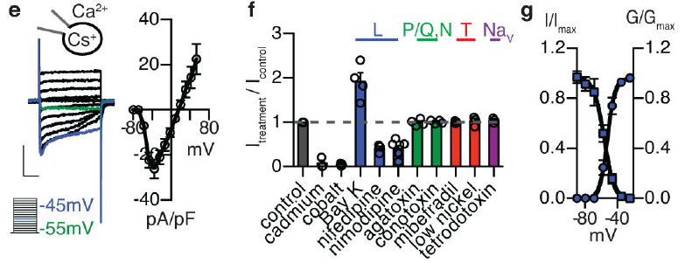
Low-threshold calcium current initiates receptor activity
Bellono and colleagues patch-clamped dissociated little-skate electrosensory cells. Voltage clamp holds membrane voltage at commanded values while measuring current. Intracellular cesium suppressed potassium currents, revealing an inward calcium current activated at unusually negative membrane potentials.
Native calcium conductance reached half-maximal activation near −52 mV. Inactivation reduces channel availability during sustained stimulation. Its slow development left a window current, persistent activity where activation and availability overlap, between approximately −70 and −30 mV. The window peaked near −58 mV, close to the receptor’s normal operating voltage.
L-type calcium-channel modulators altered this current, whereas tested sodium-channel and several other calcium-channel antagonists did not. Pharmacology identified a functional channel class; transcript measurements subsequently implicated CaV1.3. Calcium entry can depolarize the receptor and drive release, but these recordings do not equate membrane voltage with environmental field gradient.
Bellono et al. (2017), Fig. 1(e–g). Low-threshold calcium currents and channel pharmacology.
Bellono et al. (2017), Fig. 1(c–d). Isolated ampulla and receptor cell.
Bellono et al. (2017)
26
Notes:
• Bellono and colleagues patch-clamped dissociated little-skate electrosensory cells. Voltage clamp holds membrane voltage at commanded values while measuring current. Intracellular cesium suppressed potassium currents, revealing an inward calcium current activated at unusually negative membrane potentials.
– An inward current reflects positive charge entering the cell under these conditions. Activation and inactivation were measured with distinct pulse protocols, so their overlap describes available sustained current rather than a separate ion-channel species. Direct membrane measurements complement organ-level amplification experiments.
• Native calcium conductance reached half-maximal activation near −52 mV. Inactivation reduces channel availability during sustained stimulation. Its slow development left a window current, persistent activity where activation and availability overlap, between approximately −70 and −30 mV. The window peaked near −58 mV, close to the receptor’s normal operating voltage.
• L-type calcium-channel modulators altered this current, whereas tested sodium-channel and several other calcium-channel antagonists did not. Pharmacology identified a functional channel class; transcript measurements subsequently implicated CaV1.3. Calcium entry can depolarize the receptor and drive release, but these recordings do not equate membrane voltage with environmental field gradient.
References:
Bellono NW, Leitch DB, Julius D (2017). Molecular basis of ancestral vertebrate electroreception. Nature 543(7645):391-396. https://doi.org/10.1038/nature21401
Figure: Bellono et al. (2017), Fig. 1(e–g). Low-threshold calcium currents and channel pharmacology.
Figure source: https://doi.org/10.1038/nature21401
Figure: Bellono et al. (2017), Fig. 1(c–d). Isolated ampulla and receptor cell.
Figure source: https://doi.org/10.1038/nature21401

Slide 27
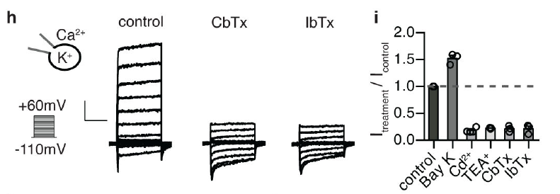
Calcium entry recruits an outward BK current
Bellono and colleagues replaced the cesium-based recording solution with a potassium-based solution to measure receptor outward currents. Calcium-activated potassium channels open more readily when intracellular calcium rises. Potassium efflux counteracts calcium-driven depolarization and can return the membrane toward negative voltages.
The outward current was reduced by tetraethylammonium and selective BK antagonists, including iberiotoxin and charybdotoxin. Calcium-channel inhibition also reduced it, whereas enhancing calcium entry increased potassium current. These linked perturbations support functional coupling between inward calcium current and BK-mediated outward current.
The coupling supplies negative feedback: depolarization opens calcium channels, calcium recruits BK, and potassium current promotes repolarization. Blocker sensitivity does not establish that every potassium channel in the organ is BK or determine a direct physical binding between channel proteins. The evidence concerns the dominant measured receptor-cell current.
Bellono et al. (2017), Fig. 1(h–i). Calcium-dependent potassium current and BK blockade.
Bellono et al. (2017), Fig. 1(c–d). Isolated ampulla and receptor cell.
Bellono et al. (2017)
27
Notes:
• Bellono and colleagues replaced the cesium-based recording solution with a potassium-based solution to measure receptor outward currents. Calcium-activated potassium channels open more readily when intracellular calcium rises. Potassium efflux counteracts calcium-driven depolarization and can return the membrane toward negative voltages.
– The receptor’s outward current depended on calcium availability, distinguishing it from a purely voltage-gated potassium conductance. Drug effects were assessed on measured currents rather than assigned solely from gene names. A feedback relationship can exist through local calcium signaling without requiring a stable channel complex.
• The outward current was reduced by tetraethylammonium and selective BK antagonists, including iberiotoxin and charybdotoxin. Calcium-channel inhibition also reduced it, whereas enhancing calcium entry increased potassium current. These linked perturbations support functional coupling between inward calcium current and BK-mediated outward current.
• The coupling supplies negative feedback: depolarization opens calcium channels, calcium recruits BK, and potassium current promotes repolarization. Blocker sensitivity does not establish that every potassium channel in the organ is BK or determine a direct physical binding between channel proteins. The evidence concerns the dominant measured receptor-cell current.
References:
Bellono NW, Leitch DB, Julius D (2017). Molecular basis of ancestral vertebrate electroreception. Nature 543(7645):391-396. https://doi.org/10.1038/nature21401
Figure: Bellono et al. (2017), Fig. 1(h–i). Calcium-dependent potassium current and BK blockade.
Figure source: https://doi.org/10.1038/nature21401
Figure: Bellono et al. (2017), Fig. 1(c–d). Isolated ampulla and receptor cell.
Figure source: https://doi.org/10.1038/nature21401

Slide 28
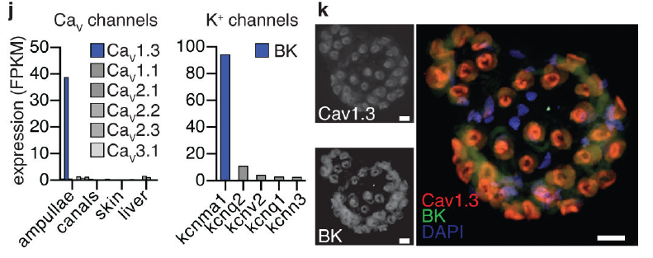
Receptor cells strongly enrich CaV1.3 and BK transcripts
Bellono and colleagues sequenced RNA from little-skate ampullary organs and comparison tissues. A transcript is an RNA copy of a gene. The gene cacna1d, encoding CaV1.3’s pore-forming subunit, was enriched more than 90-fold relative to other tissues examined.
The BK pore-forming gene kcnma1 was expressed more than 35-fold above other calcium-activated potassium-channel genes in ampullae. In situ hybridization localized CaV1.3 and BK transcripts together in electrosensory cells, with little detectable signal in supporting cells or canal structures.
Expression specificity links the pharmacologically identified currents to molecular candidates in the appropriate cells. RNA abundance alone neither measures membrane-channel number nor proves channel function. Agreement among current recordings, blocker responses, expression, and cellular localization strengthens the assignment while leaving minor conductances or additional regulatory proteins possible.
Bellono et al. (2017), Fig. 1(j–k). Channel transcript enrichment and cellular colocalization.
Bellono et al. (2017), Fig. 1(c–d). Isolated ampulla and receptor cell.
Bellono et al. (2017)
28
Notes:
• Bellono and colleagues sequenced RNA from little-skate ampullary organs and comparison tissues. A transcript is an RNA copy of a gene. The gene cacna1d, encoding CaV1.3’s pore-forming subunit, was enriched more than 90-fold relative to other tissues examined.
– In situ hybridization uses complementary probes to locate particular RNA sequences in tissue. It differs from antibody staining of protein and from whole-tissue sequencing. Combining these methods reduces the possibility that an abundant transcript originated only from an unrelated cell type within the sampled organ.
• The BK pore-forming gene kcnma1 was expressed more than 35-fold above other calcium-activated potassium-channel genes in ampullae. In situ hybridization localized CaV1.3 and BK transcripts together in electrosensory cells, with little detectable signal in supporting cells or canal structures.
• Expression specificity links the pharmacologically identified currents to molecular candidates in the appropriate cells. RNA abundance alone neither measures membrane-channel number nor proves channel function. Agreement among current recordings, blocker responses, expression, and cellular localization strengthens the assignment while leaving minor conductances or additional regulatory proteins possible.
References:
Bellono NW, Leitch DB, Julius D (2017). Molecular basis of ancestral vertebrate electroreception. Nature 543(7645):391-396. https://doi.org/10.1038/nature21401
Figure: Bellono et al. (2017), Fig. 1(j–k). Channel transcript enrichment and cellular colocalization.
Figure source: https://doi.org/10.1038/nature21401
Figure: Bellono et al. (2017), Fig. 1(c–d). Isolated ampulla and receptor cell.
Figure source: https://doi.org/10.1038/nature21401

Slide 29
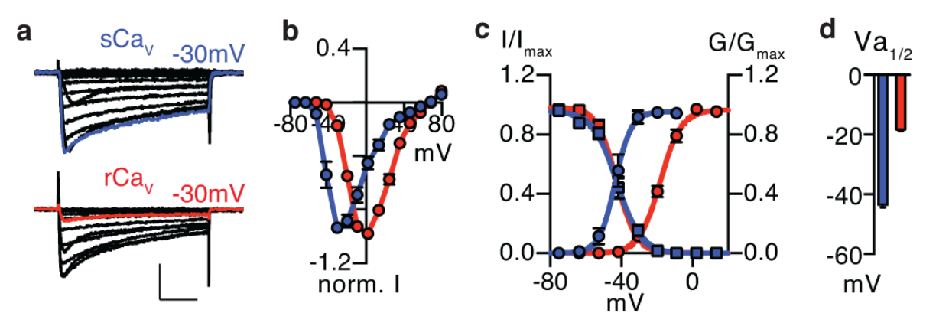
Skate CaV1.3 opens at more negative voltages
Bellono and colleagues expressed cloned skate and rat CaV1.3 channels in HEK293 cells, a mammalian cell line used for controlled channel measurements. Matched recording conditions tested whether low-threshold activation was intrinsic to the skate channel rather than unique to the intact receptor environment.
Half-maximal activation was approximately −42.7 mV for skate CaV1.3 and −18.2 mV for the rat long isoform. Their inactivation relations were similar, so the negative shift in activation enlarged the skate channel’s window-current range. Current traces and normalized conductance curves supported the same comparison.
The channel sequence therefore contributes directly to low-voltage opening. The cloned channel’s activation value differs from the native receptor value near −52 mV because experimental context and associated proteins can modify gating. Heterologous expression isolates molecular properties but does not reproduce the entire ampullary epithelium or sensory pathway.
Bellono et al. (2017), Fig. 2(a–d). Skate and rat CaV1.3 activation properties.
Bellono et al. (2017), Fig. 1(c–d). Isolated ampulla and receptor cell.
Bellono et al. (2017)
29
Notes:
• Bellono and colleagues expressed cloned skate and rat CaV1.3 channels in HEK293 cells, a mammalian cell line used for controlled channel measurements. Matched recording conditions tested whether low-threshold activation was intrinsic to the skate channel rather than unique to the intact receptor environment.
– Conductance describes the channel-mediated relation between electrical driving force and current. Normalization permits comparison of opening behavior despite differences in expression level. The rat comparison was to a specified isoform, so it should not be generalized to every mammalian CaV1.3 splice variant.
• Half-maximal activation was approximately −42.7 mV for skate CaV1.3 and −18.2 mV for the rat long isoform. Their inactivation relations were similar, so the negative shift in activation enlarged the skate channel’s window-current range. Current traces and normalized conductance curves supported the same comparison.
• The channel sequence therefore contributes directly to low-voltage opening. The cloned channel’s activation value differs from the native receptor value near −52 mV because experimental context and associated proteins can modify gating. Heterologous expression isolates molecular properties but does not reproduce the entire ampullary epithelium or sensory pathway.
References:
Bellono NW, Leitch DB, Julius D (2017). Molecular basis of ancestral vertebrate electroreception. Nature 543(7645):391-396. https://doi.org/10.1038/nature21401
Figure: Bellono et al. (2017), Fig. 2(a–d). Skate and rat CaV1.3 activation properties.
Figure source: https://doi.org/10.1038/nature21401
Figure: Bellono et al. (2017), Fig. 1(c–d). Isolated ampulla and receptor cell.
Figure source: https://doi.org/10.1038/nature21401

Slide 30
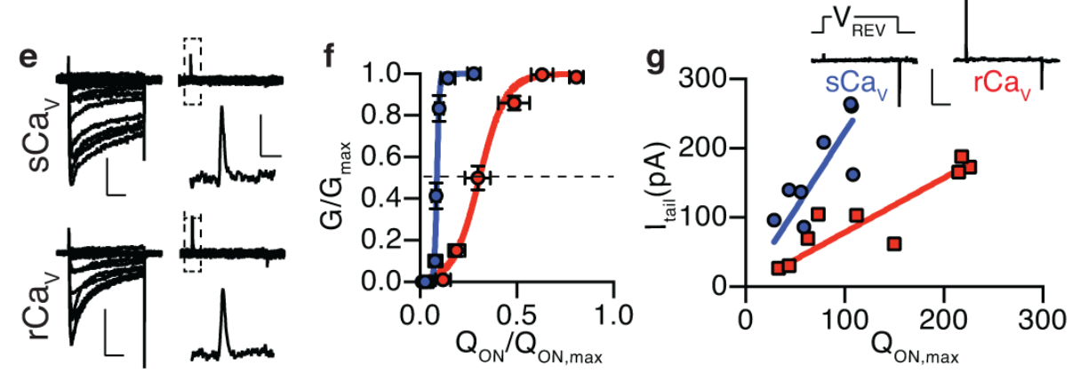
Efficient sensor–pore coupling lowers activation voltage
A voltage-gated channel contains voltage-sensitive elements coupled to an ion-conducting pore. Gating current records charge movement within these elements rather than ion flow through the open pore. Bellono and colleagues measured both gating charge and ionic conductance in cells expressing skate or rat CaV1.3.
Their voltage-dependent charge movement was broadly similar, yet skate channels achieved substantial conductance with less relative sensor movement. Returning from a depolarizing command to −100 mV also produced larger skate tail currents for comparable gating charge. A tail current reports open channels after the voltage change.
The low threshold therefore reflects enhanced coupling between sensor movement and pore opening, rather than merely a larger number of moving charges. These functional measurements constrain gating mechanisms without resolving the channel’s complete three-dimensional structure. A small domain-specific sensor shift could also escape measurements combining all four channel domains.
Bellono et al. (2017), Fig. 2(e–g). Gating charge and pore-opening efficiency.
Bellono et al. (2017), Fig. 1(c–d). Isolated ampulla and receptor cell.
Bellono et al. (2017)
30
Notes:
• A voltage-gated channel contains voltage-sensitive elements coupled to an ion-conducting pore. Gating current records charge movement within these elements rather than ion flow through the open pore. Bellono and colleagues measured both gating charge and ionic conductance in cells expressing skate or rat CaV1.3.
– A voltage sensor can move without producing maximal pore opening if coupling is inefficient. Ionic and gating recordings separate these two steps experimentally. The authors subsequently used sequence mutations to identify a region capable of changing that coupling, rather than relying on the comparison alone.
• Their voltage-dependent charge movement was broadly similar, yet skate channels achieved substantial conductance with less relative sensor movement. Returning from a depolarizing command to −100 mV also produced larger skate tail currents for comparable gating charge. A tail current reports open channels after the voltage change.
• The low threshold therefore reflects enhanced coupling between sensor movement and pore opening, rather than merely a larger number of moving charges. These functional measurements constrain gating mechanisms without resolving the channel’s complete three-dimensional structure. A small domain-specific sensor shift could also escape measurements combining all four channel domains.
References:
Bellono NW, Leitch DB, Julius D (2017). Molecular basis of ancestral vertebrate electroreception. Nature 543(7645):391-396. https://doi.org/10.1038/nature21401
Figure: Bellono et al. (2017), Fig. 2(e–g). Gating charge and pore-opening efficiency.
Figure source: https://doi.org/10.1038/nature21401
Figure: Bellono et al. (2017), Fig. 1(c–d). Isolated ampulla and receptor cell.
Figure source: https://doi.org/10.1038/nature21401

Slide 31
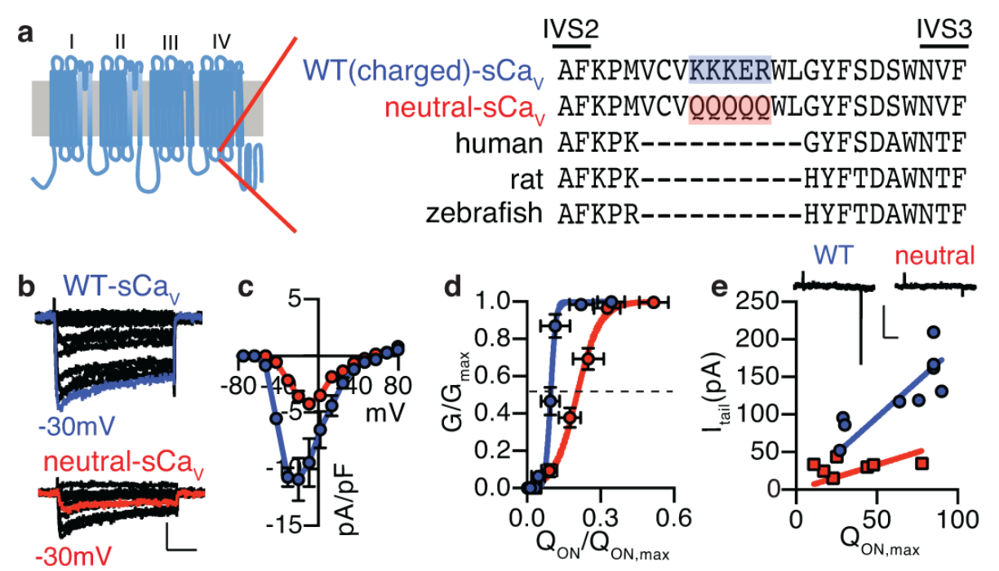
A charged CaV1.3 motif is necessary for low threshold
Comparing CaV1.3 sequences identified a skate insertion in an intracellular loop of domain IV. A motif is a short sequence with a characteristic structural or functional role. The insertion KKKER adds net positive charge between transmembrane segments S2 and S3.
Bellono and colleagues replaced its charged residues with neutral glutamines, producing QQQQQ. In the matched mutation experiment, half-maximal activation shifted from approximately −37.2 mV in the wild-type skate channel to −26.0 mV in the neutralized channel. Sensor–pore coupling also weakened without a comparable change in total gating-charge behavior.
The controlled substitution establishes a causal contribution of these residues to low-threshold activation. Electrostatic repulsion of the nearby voltage sensor was proposed as an explanation, supported by kinetic tests. The study did not directly image that interaction, and sequence-dependent gating should be distinguished from a solved structural mechanism.
Bellono et al. (2017), Fig. 3(a–e). Charge-neutralization tests the skate channel motif.
Bellono et al. (2017), Fig. 1(c–d). Isolated ampulla and receptor cell.
Bellono et al. (2017)
31
Notes:
• Comparing CaV1.3 sequences identified a skate insertion in an intracellular loop of domain IV. A motif is a short sequence with a characteristic structural or functional role. The insertion KKKER adds net positive charge between transmembrane segments S2 and S3.
– A mutation changes the tested channel sequence while the expression system and recording protocol remain matched. The result concerns the effect of the charged insertion within this molecular background. Its causal importance does not imply that it is the only residue or regulatory influence governing native receptor sensitivity.
• Bellono and colleagues replaced its charged residues with neutral glutamines, producing QQQQQ. In the matched mutation experiment, half-maximal activation shifted from approximately −37.2 mV in the wild-type skate channel to −26.0 mV in the neutralized channel. Sensor–pore coupling also weakened without a comparable change in total gating-charge behavior.
• The controlled substitution establishes a causal contribution of these residues to low-threshold activation. Electrostatic repulsion of the nearby voltage sensor was proposed as an explanation, supported by kinetic tests. The study did not directly image that interaction, and sequence-dependent gating should be distinguished from a solved structural mechanism.
References:
Bellono NW, Leitch DB, Julius D (2017). Molecular basis of ancestral vertebrate electroreception. Nature 543(7645):391-396. https://doi.org/10.1038/nature21401
Figure: Bellono et al. (2017), Fig. 3(a–e). Charge-neutralization tests the skate channel motif.
Figure source: https://doi.org/10.1038/nature21401
Figure: Bellono et al. (2017), Fig. 1(c–d). Isolated ampulla and receptor cell.
Figure source: https://doi.org/10.1038/nature21401

Slide 32
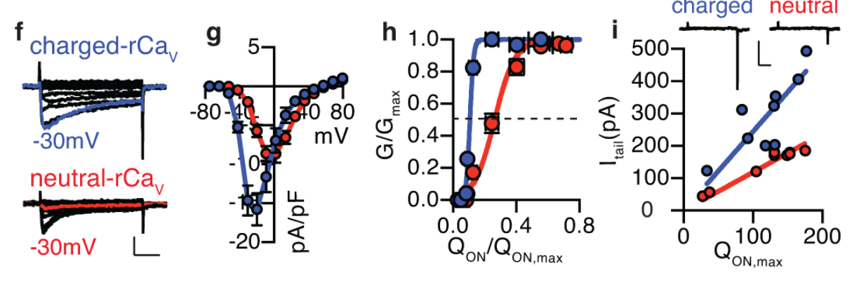
The skate motif transfers sensitivity to a rat channel
Bellono and colleagues inserted the charged skate motif into rat CaV1.3 and compared it with an otherwise comparable neutral insertion. This gain-of-function experiment asks whether the sequence can confer a property on a channel that normally lacks it, complementing its neutralization in skate.
The charged rat construct activated at more negative potentials than the neutral construct; reported half-activation values were approximately −37.2 and −19.6 mV. Conductance required less relative gating charge, and tail currents increased for comparable charge movement. The transferred motif altered coupling as well as the activation curve.
Necessity and transfer experiments together provide stronger causal evidence than sequence correlation alone. Their measurements concern cloned channels in transfected cells, not a genetically modified hunting skate. The authors’ voltage-sensor priming model remains a mechanistic interpretation requiring structural confirmation despite the established sequence-dependent functional change.
Bellono et al. (2017), Fig. 3(f–i). Transfer of the skate motif alters rat channel gating.
Bellono et al. (2017), Fig. 1(c–d). Isolated ampulla and receptor cell.
Bellono et al. (2017)
32
Notes:
• Bellono and colleagues inserted the charged skate motif into rat CaV1.3 and compared it with an otherwise comparable neutral insertion. This gain-of-function experiment asks whether the sequence can confer a property on a channel that normally lacks it, complementing its neutralization in skate.
– The neutral insertion controlled for adding a short sequence without its positive charge. Comparisons within each experiment avoid treating values from different expression protocols as a single absolute threshold. The molecular result supplies a plausible amplification component rather than a complete explanation of behavioral field sensitivity.
• The charged rat construct activated at more negative potentials than the neutral construct; reported half-activation values were approximately −37.2 and −19.6 mV. Conductance required less relative gating charge, and tail currents increased for comparable charge movement. The transferred motif altered coupling as well as the activation curve.
• Necessity and transfer experiments together provide stronger causal evidence than sequence correlation alone. Their measurements concern cloned channels in transfected cells, not a genetically modified hunting skate. The authors’ voltage-sensor priming model remains a mechanistic interpretation requiring structural confirmation despite the established sequence-dependent functional change.
References:
Bellono NW, Leitch DB, Julius D (2017). Molecular basis of ancestral vertebrate electroreception. Nature 543(7645):391-396. https://doi.org/10.1038/nature21401
Figure: Bellono et al. (2017), Fig. 3(f–i). Transfer of the skate motif alters rat channel gating.
Figure source: https://doi.org/10.1038/nature21401
Figure: Bellono et al. (2017), Fig. 1(c–d). Isolated ampulla and receptor cell.
Figure source: https://doi.org/10.1038/nature21401

Slide 33
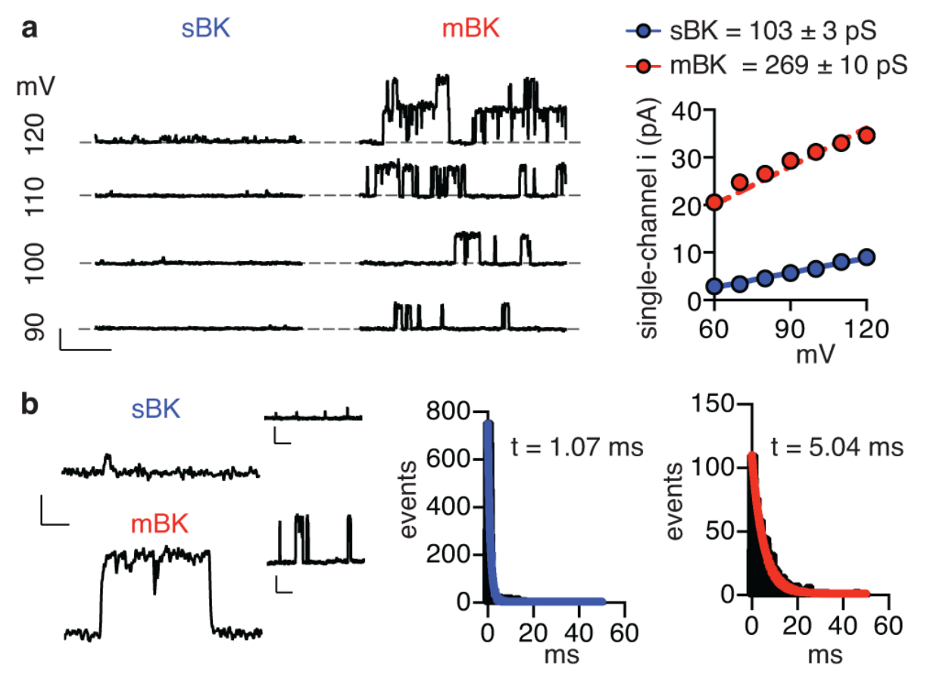
Skate BK passes less current per channel opening
Bellono and colleagues recorded individual BK channels in excised membrane patches from cells expressing skate or mouse subunits. Single-channel conductance measures current carried by one open channel for a specified driving force. This separates molecular pore behavior from whole-cell channel abundance.
The skate channel had smaller current amplitudes and shorter openings than mouse BK. At 80 mV, open-time constants were approximately 1.09 ms and 5.06 ms, respectively. Their calcium sensitivity was broadly similar, so the difference was not simply a failure of skate channels to respond to calcium.
Smaller and briefer potassium currents can restrain, rather than immediately terminate, calcium-driven depolarization. This provides a mechanism for tuning receptor oscillations. The functional consequence in native cells requires further perturbation because excised patches lack the receptor’s calcium gradients, accessory proteins, and intact membrane geometry.
Bellono et al. (2017), Fig. 4(a–b). Single-channel currents and open-time distributions.
Bellono et al. (2017), Fig. 1(c–d). Isolated ampulla and receptor cell.
Bellono et al. (2017)
33
Notes:
• Bellono and colleagues recorded individual BK channels in excised membrane patches from cells expressing skate or mouse subunits. Single-channel conductance measures current carried by one open channel for a specified driving force. This separates molecular pore behavior from whole-cell channel abundance.
– Channel openings appear as discrete current steps in the original recordings. Their amplitudes and durations answer different questions: how rapidly ions pass through an open pore, and how long the pore remains open. Both can change the amount of potassium charge crossing the membrane.
• The skate channel had smaller current amplitudes and shorter openings than mouse BK. At 80 mV, open-time constants were approximately 1.09 ms and 5.06 ms, respectively. Their calcium sensitivity was broadly similar, so the difference was not simply a failure of skate channels to respond to calcium.
• Smaller and briefer potassium currents can restrain, rather than immediately terminate, calcium-driven depolarization. This provides a mechanism for tuning receptor oscillations. The functional consequence in native cells requires further perturbation because excised patches lack the receptor’s calcium gradients, accessory proteins, and intact membrane geometry.
References:
Bellono NW, Leitch DB, Julius D (2017). Molecular basis of ancestral vertebrate electroreception. Nature 543(7645):391-396. https://doi.org/10.1038/nature21401
Figure: Bellono et al. (2017), Fig. 4(a–b). Single-channel currents and open-time distributions.
Figure source: https://doi.org/10.1038/nature21401
Figure: Bellono et al. (2017), Fig. 1(c–d). Isolated ampulla and receptor cell.
Figure source: https://doi.org/10.1038/nature21401

Slide 34
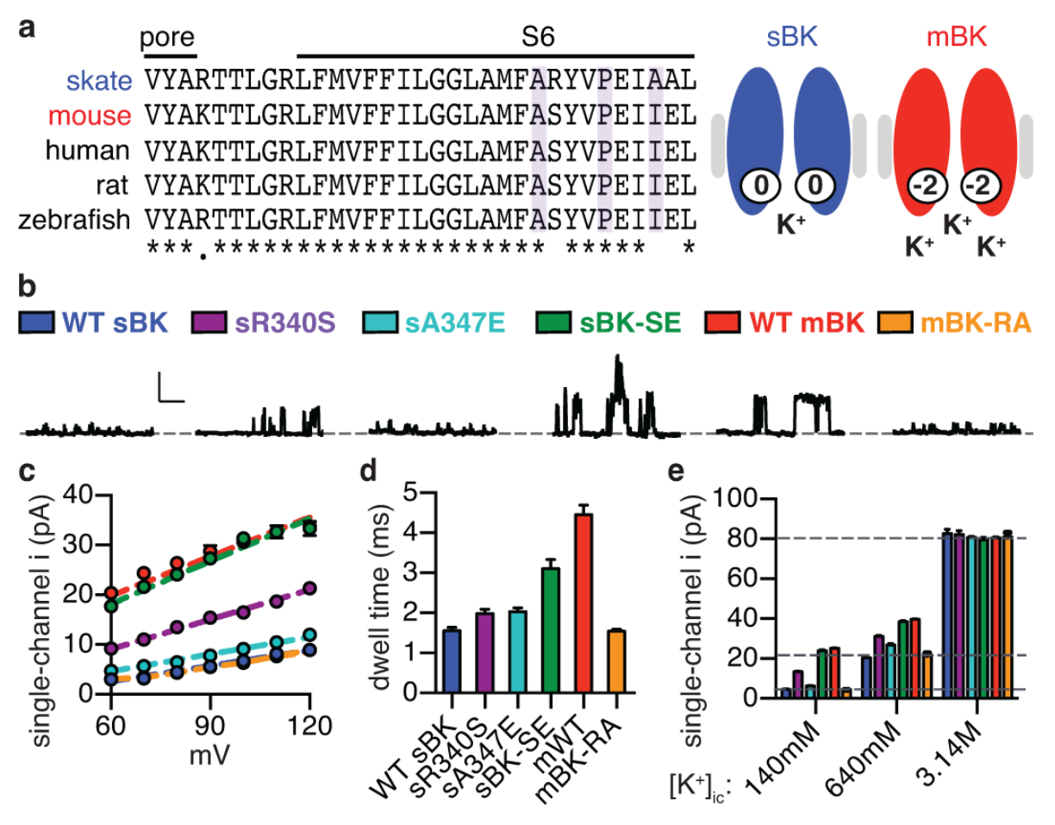
Reciprocal BK mutations identify pore adaptations
Bellono and colleagues substituted two skate BK residues with their mouse counterparts and performed the reciprocal substitutions in mouse BK. These residues lie near the intracellular pore, where local charge can influence potassium concentration. The comparison tested functional effects rather than sequence similarity alone.
Wild-type skate conductance was approximately 104 pS, versus 263 pS for mouse BK. The double-mutant skate channel reached approximately 287 pS, while the reciprocal mouse construct fell near 97 pS. Open-time behavior also shifted toward the species supplying the substituted residues.
Increasing intracellular potassium to a saturating 3.14 M equalized current amplitudes, supporting an electrostatic contribution to local ion availability rather than an intrinsically impassable skate pore. The very high potassium condition is an experimental probe, not a physiological receptor concentration. Reciprocal mutations establish sequence-dependent function without proving adaptive history directly.
Bellono et al. (2017), Fig. 5(a–e). Reciprocal mutations alter BK conductance and kinetics.
Bellono et al. (2017), Fig. 1(c–d). Isolated ampulla and receptor cell.
Bellono et al. (2017)
34
Notes:
• Bellono and colleagues substituted two skate BK residues with their mouse counterparts and performed the reciprocal substitutions in mouse BK. These residues lie near the intracellular pore, where local charge can influence potassium concentration. The comparison tested functional effects rather than sequence similarity alone.
– A picosiemens is a unit of electrical conductance. The effect of a substitution on current amplitude was examined alongside opening duration, and the two properties were not assumed identical. High-potassium experiments tested whether the channels retained a common maximum ion-passage capacity.
• Wild-type skate conductance was approximately 104 pS, versus 263 pS for mouse BK. The double-mutant skate channel reached approximately 287 pS, while the reciprocal mouse construct fell near 97 pS. Open-time behavior also shifted toward the species supplying the substituted residues.
• Increasing intracellular potassium to a saturating 3.14 M equalized current amplitudes, supporting an electrostatic contribution to local ion availability rather than an intrinsically impassable skate pore. The very high potassium condition is an experimental probe, not a physiological receptor concentration. Reciprocal mutations establish sequence-dependent function without proving adaptive history directly.
References:
Bellono NW, Leitch DB, Julius D (2017). Molecular basis of ancestral vertebrate electroreception. Nature 543(7645):391-396. https://doi.org/10.1038/nature21401
Figure: Bellono et al. (2017), Fig. 5(a–e). Reciprocal mutations alter BK conductance and kinetics.
Figure source: https://doi.org/10.1038/nature21401
Figure: Bellono et al. (2017), Fig. 1(c–d). Isolated ampulla and receptor cell.
Figure source: https://doi.org/10.1038/nature21401

Slide 35
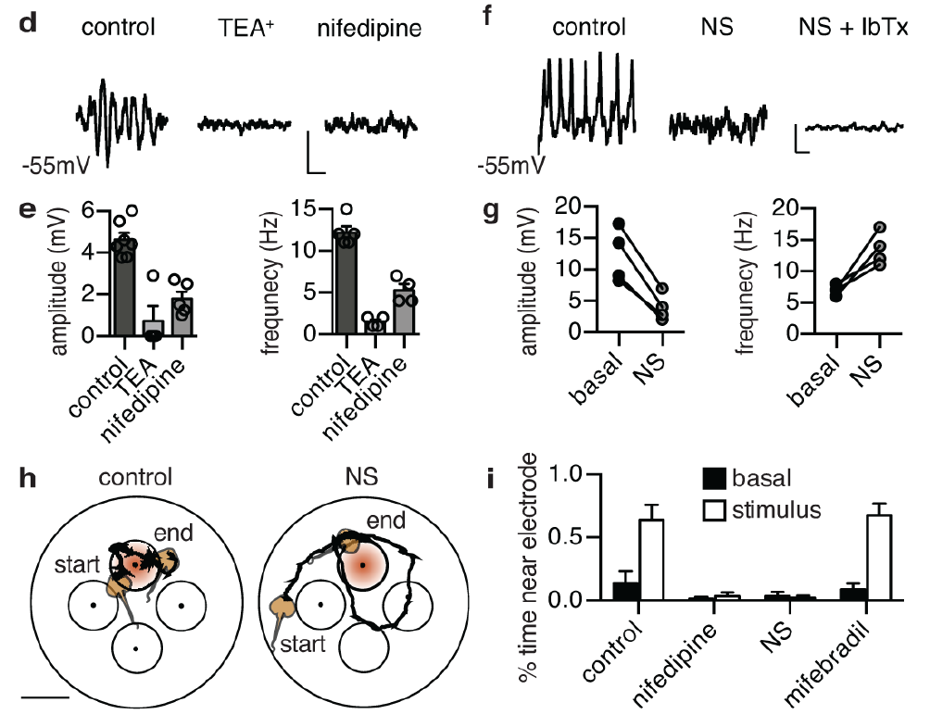
Channel modulation changes oscillations and behavior
Bellono and colleagues recorded spontaneous voltage oscillations in little-skate receptors and then manipulated channel activity. Nifedipine reduced calcium-dependent activity; BK blockade disrupted oscillations. The BK activator NS11021 reduced oscillation amplitude while increasing frequency, consistent with stronger repolarizing current.
Behaving skates were tested for preference toward a buried dipole during 30-minute trials. Vehicle and a calcium-channel drug ineffective against the measured current preserved target preference, whereas nifedipine and NS11021 reduced time near the active electrode. Subsequent startle tests checked for gross mobility impairment.
The paired physiological and behavioral perturbations connect channel activity to electrosensory performance. Whole-animal drug exposure is not restricted to the ampullae, so it does not prove that every behavioral effect originates exclusively in receptor cells. Startle controls limit a general motor explanation while leaving more specific sensory or systemic effects possible.
Bellono et al. (2017), Fig. 6(d–i). Channel modulation alters oscillations and dipole-zone preference.
Bellono et al. (2017), Fig. 1(c–d). Isolated ampulla and receptor cell.
Bellono et al. (2017)
35
Notes:
• Bellono and colleagues recorded spontaneous voltage oscillations in little-skate receptors and then manipulated channel activity. Nifedipine reduced calcium-dependent activity; BK blockade disrupted oscillations. The BK activator NS11021 reduced oscillation amplitude while increasing frequency, consistent with stronger repolarizing current.
– A BK activator is not equivalent to removing potassium feedback: stronger activity changes the balance between calcium-driven depolarization and repolarization. The behavioral result depends on that balance, rather than simply on the presence or absence of any potassium channel. Pharmacological specificity must be evaluated at both cellular and organismal levels.
• Behaving skates were tested for preference toward a buried dipole during 30-minute trials. Vehicle and a calcium-channel drug ineffective against the measured current preserved target preference, whereas nifedipine and NS11021 reduced time near the active electrode. Subsequent startle tests checked for gross mobility impairment.
• The paired physiological and behavioral perturbations connect channel activity to electrosensory performance. Whole-animal drug exposure is not restricted to the ampullae, so it does not prove that every behavioral effect originates exclusively in receptor cells. Startle controls limit a general motor explanation while leaving more specific sensory or systemic effects possible.
References:
Bellono NW, Leitch DB, Julius D (2017). Molecular basis of ancestral vertebrate electroreception. Nature 543(7645):391-396. https://doi.org/10.1038/nature21401
Figure: Bellono et al. (2017), Fig. 6(d–i). Channel modulation alters oscillations and dipole-zone preference.
Figure source: https://doi.org/10.1038/nature21401
Figure: Bellono et al. (2017), Fig. 1(c–d). Isolated ampulla and receptor cell.
Figure source: https://doi.org/10.1038/nature21401

Slide 36
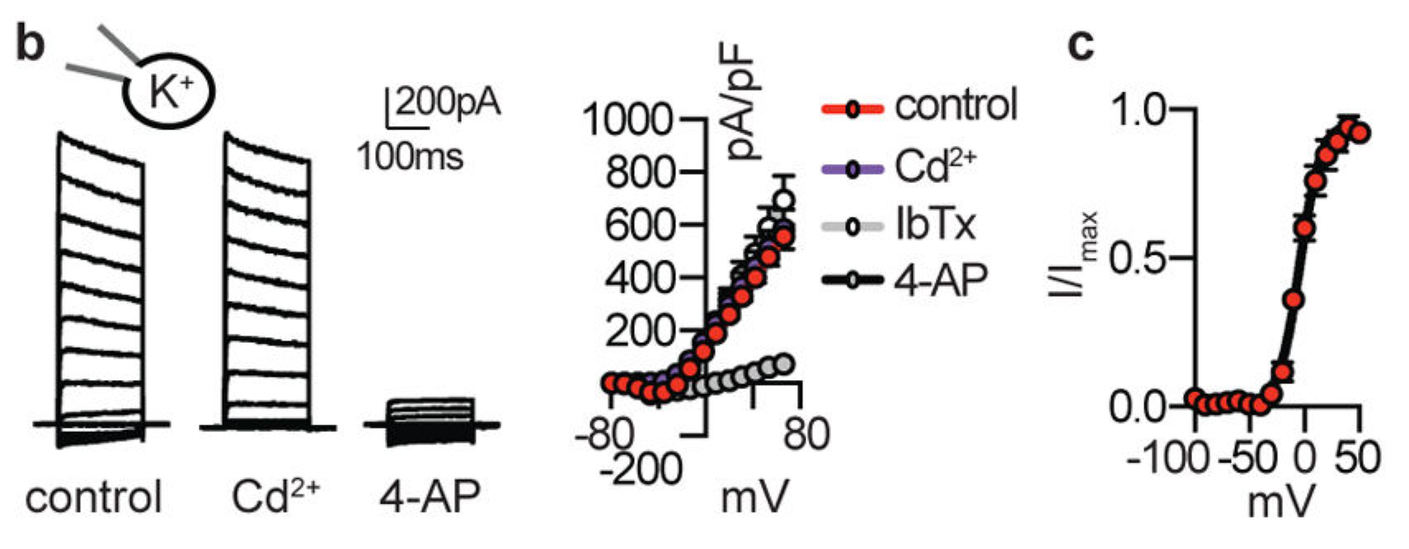
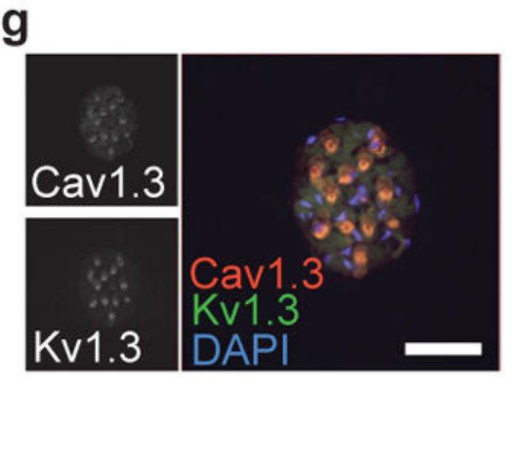
Shark receptor potassium current is voltage-gated
Bellono and colleagues compared chain catshark, Scyliorhinus retifer, receptors with little-skate receptors. Shark outward current activated at more positive voltages than the calcium current. Unlike skate current, it was not reduced by calcium-current blockade or the tested BK antagonist.
The voltage-gated potassium blocker 4-aminopyridine, or 4-AP, inhibited shark outward current. Rapid activation and deactivation, together with weak slow inactivation, supported repetitive responses. Repeated depolarizing commands did not appreciably diminish the measured outward-current amplitude under the tested conditions.
The results identify a different functional potassium mechanism despite both species using low-threshold calcium entry. BK transcripts in shark tissue did not establish a dominant BK current. The conclusion concerns the measured species and preparation; channel contributions may differ with developmental stage, cellular compartment, or physiological state.
Bellono et al. (2018), Fig. 1(b–c). Shark potassium current activation and blocker sensitivity.
Bellono et al. (2018), Fig. 1(g). Catshark receptor cells: CaV1.3 and KV1.3 transcripts.
Bellono et al. (2018); Bellono et al. (2017)
36
Notes:
• Bellono and colleagues compared chain catshark, Scyliorhinus retifer, receptors with little-skate receptors. Shark outward current activated at more positive voltages than the calcium current. Unlike skate current, it was not reduced by calcium-current blockade or the tested BK antagonist.
– An outward potassium current can be activated directly by voltage or indirectly through rising calcium. Blocker comparisons and calcium dependence distinguish these alternatives experimentally. A calcium-channel antagonist served as a causal test of functional coupling, rather than treating all receptor potassium currents as interchangeable.
• The voltage-gated potassium blocker 4-aminopyridine, or 4-AP, inhibited shark outward current. Rapid activation and deactivation, together with weak slow inactivation, supported repetitive responses. Repeated depolarizing commands did not appreciably diminish the measured outward-current amplitude under the tested conditions.
• The results identify a different functional potassium mechanism despite both species using low-threshold calcium entry. BK transcripts in shark tissue did not establish a dominant BK current. The conclusion concerns the measured species and preparation; channel contributions may differ with developmental stage, cellular compartment, or physiological state.
References:
Bellono NW, Leitch DB, Julius D (2018). Molecular tuning of electroreception in sharks and skates. Nature 558(7708):122-126. https://doi.org/10.1038/s41586-018-0160-9
Bellono NW, Leitch DB, Julius D (2017). Molecular basis of ancestral vertebrate electroreception. Nature 543(7645):391-396. https://doi.org/10.1038/nature21401
Figure: Bellono et al. (2018), Fig. 1(b–c). Shark potassium current activation and blocker sensitivity.
Figure source: https://doi.org/10.1038/s41586-018-0160-9
Figure: Bellono et al. (2018), Fig. 1(g). Catshark receptor cells: CaV1.3 and KV1.3 transcripts.
Figure source: https://doi.org/10.1038/s41586-018-0160-9

Slide 37
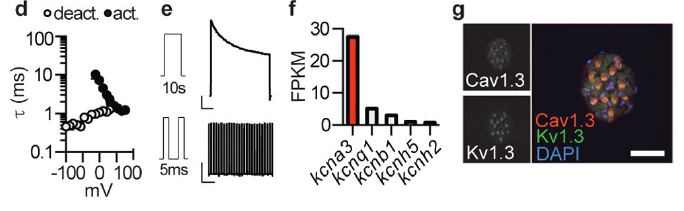
Catshark electrosensory cells enrich KV1.3
KV1.3 is a voltage-gated potassium channel assembled from pore-forming subunits encoded by a specific gene. Bellono and colleagues found its transcript predominant among voltage-gated potassium channels in chain-catshark ampullary organs. In situ hybridization localized KV1.3 together with CaV1.3 in receptor cells.
Shark KV1.3 expression was not detected in the tested skate ampullae, where BK dominated functional potassium feedback. Catshark receptor currents closed rapidly after repolarization and remained available during repeated stimulation. The expressed shark channel reproduced many native current properties when tested independently.
Agreement among cellular localization, pharmacology, and cloned-channel function supports KV1.3 as the major measured shark potassium conductance. Native currents deactivated faster than cloned currents at some voltages, leaving accessory subunits or other cellular factors relevant. The transcript assignment therefore explains much of the mechanism without implying complete molecular sufficiency.
Bellono et al. (2018), Fig. 1(d–g). Fast deactivation, transcript enrichment and receptor localization.
Bellono et al. (2018), Fig. 1(g). Catshark receptor cells: CaV1.3 and KV1.3 transcripts.
Bellono et al. (2018); Bellono et al. (2017)
37
Notes:
• KV1.3 is a voltage-gated potassium channel assembled from pore-forming subunits encoded by a specific gene. Bellono and colleagues found its transcript predominant among voltage-gated potassium channels in chain-catshark ampullary organs. In situ hybridization localized KV1.3 together with CaV1.3 in receptor cells.
– The shark brain expressed a truncated KV1.3 transcript lacking an essential assembly region rather than the same full-length receptor form. Tissue expression patterns must therefore distinguish isoforms as well as gene identity. The study did not establish that the receptor form contributes identically in every organ.
• Shark KV1.3 expression was not detected in the tested skate ampullae, where BK dominated functional potassium feedback. Catshark receptor currents closed rapidly after repolarization and remained available during repeated stimulation. The expressed shark channel reproduced many native current properties when tested independently.
• Agreement among cellular localization, pharmacology, and cloned-channel function supports KV1.3 as the major measured shark potassium conductance. Native currents deactivated faster than cloned currents at some voltages, leaving accessory subunits or other cellular factors relevant. The transcript assignment therefore explains much of the mechanism without implying complete molecular sufficiency.
References:
Bellono NW, Leitch DB, Julius D (2018). Molecular tuning of electroreception in sharks and skates. Nature 558(7708):122-126. https://doi.org/10.1038/s41586-018-0160-9
Bellono NW, Leitch DB, Julius D (2017). Molecular basis of ancestral vertebrate electroreception. Nature 543(7645):391-396. https://doi.org/10.1038/nature21401
Figure: Bellono et al. (2018), Fig. 1(d–g). Fast deactivation, transcript enrichment and receptor localization.
Figure source: https://doi.org/10.1038/s41586-018-0160-9
Figure: Bellono et al. (2018), Fig. 1(g). Catshark receptor cells: CaV1.3 and KV1.3 transcripts.
Figure source: https://doi.org/10.1038/s41586-018-0160-9

Slide 38
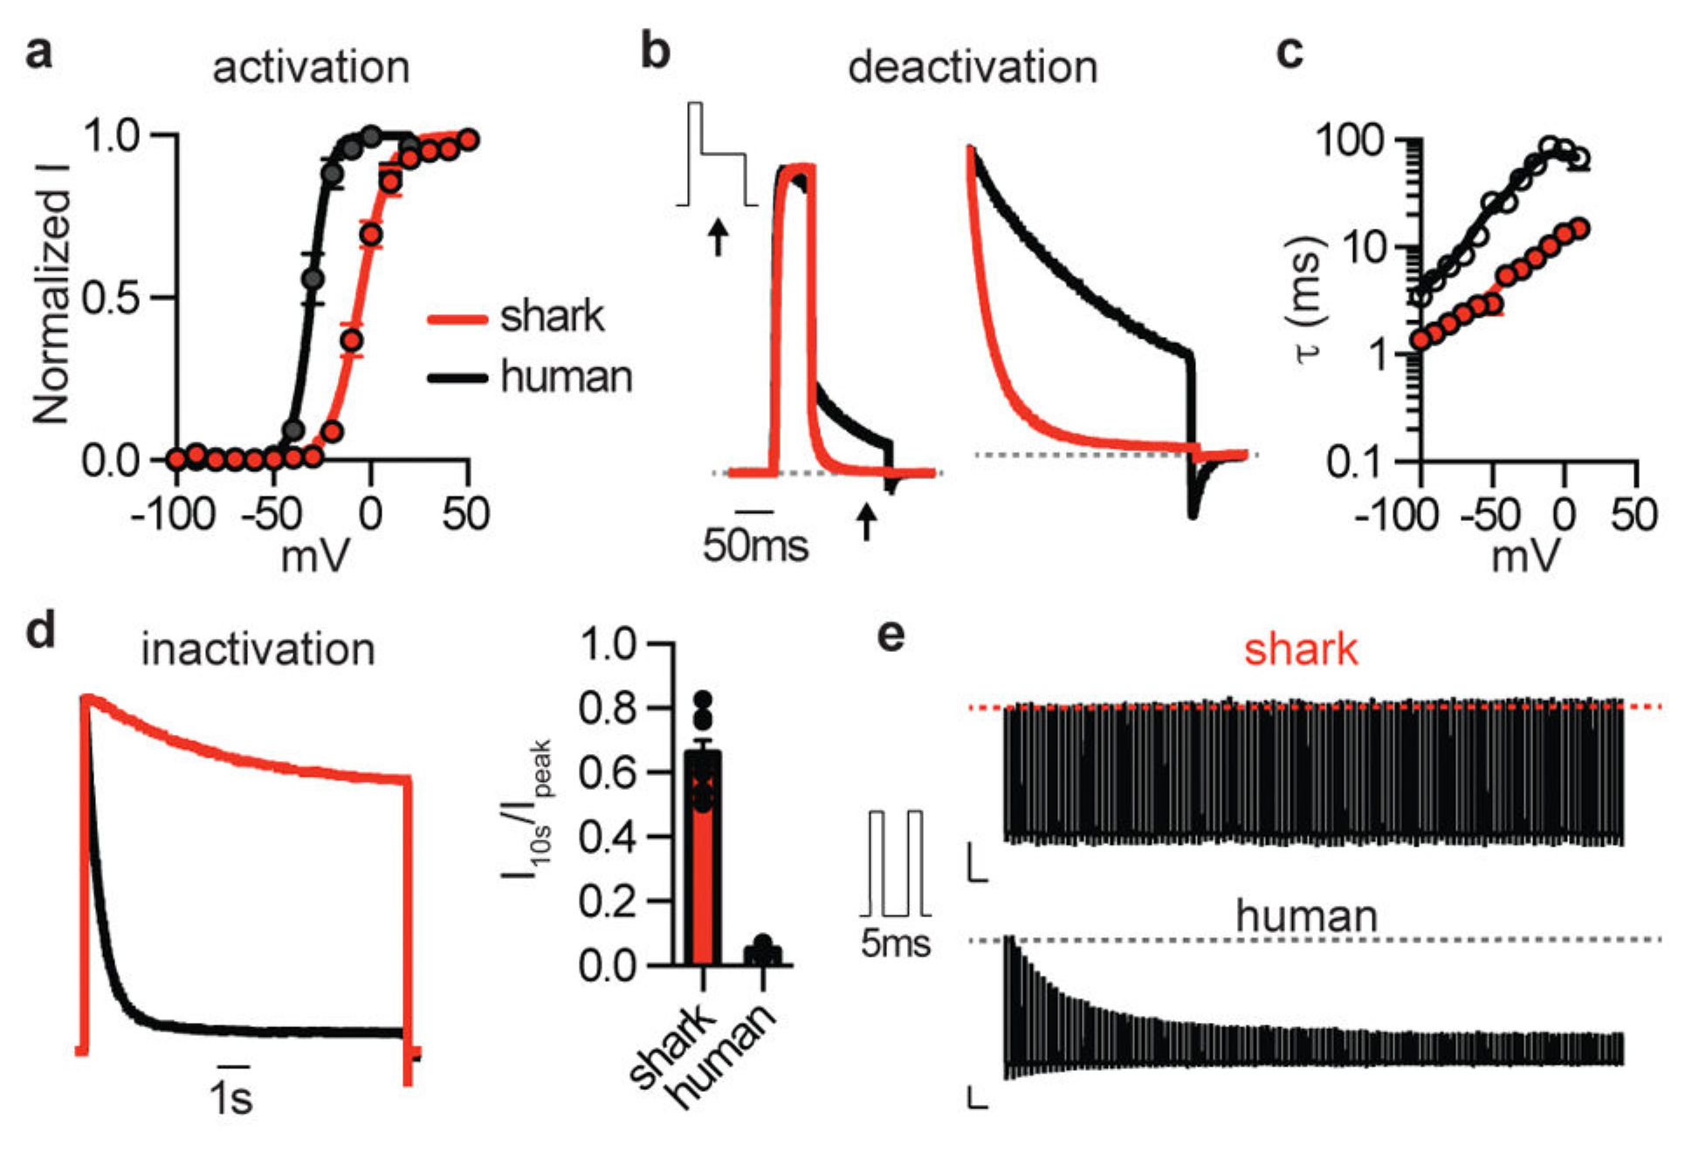
Shark KV1.3 closes rapidly and resists inactivation
Bellono and colleagues expressed shark and human KV1.3 channels under matched recording conditions. Shark half-maximal activation occurred near −5.4 mV, compared with −30.7 mV for human KV1.3. The shark channel therefore supplied outward current only after substantially greater depolarization.
Shark channels returned rapidly to a closed state and showed weak, slow inactivation during prolonged or repeated commands. Human channels progressively lost current during repetitive stimulation. The comparison separated activation threshold, deactivation, and inactivation, three distinct properties that jointly influence sustained receptor activity.
High activation voltage permits strong calcium-driven depolarization before potassium feedback intervenes; rapid closure then releases the membrane for another cycle. Sequence-swapping experiments implicated voltage-sensor regions and the outer pore in different properties. Reduced voltage-sensor relaxation was proposed from kinetic evidence, rather than directly observed as a resolved structural rearrangement.
Bellono et al. (2018), Fig. 2(a–e). Shark and human KV1.3 gating under matched stimulation.
Bellono et al. (2018), Fig. 1(g). Catshark receptor cells: CaV1.3 and KV1.3 transcripts.
Bellono et al. (2018); Bellono et al. (2017)
38
Notes:
• Bellono and colleagues expressed shark and human KV1.3 channels under matched recording conditions. Shark half-maximal activation occurred near −5.4 mV, compared with −30.7 mV for human KV1.3. The shark channel therefore supplied outward current only after substantially greater depolarization.
– Inactivation limits availability during sustained stimulation, whereas deactivation closes channels as voltage returns toward rest. A channel can deactivate rapidly yet remain ready to reopen. The distinction explains why repetitive currents can remain large without requiring channels to stay continuously open.
• Shark channels returned rapidly to a closed state and showed weak, slow inactivation during prolonged or repeated commands. Human channels progressively lost current during repetitive stimulation. The comparison separated activation threshold, deactivation, and inactivation, three distinct properties that jointly influence sustained receptor activity.
• High activation voltage permits strong calcium-driven depolarization before potassium feedback intervenes; rapid closure then releases the membrane for another cycle. Sequence-swapping experiments implicated voltage-sensor regions and the outer pore in different properties. Reduced voltage-sensor relaxation was proposed from kinetic evidence, rather than directly observed as a resolved structural rearrangement.
References:
Bellono NW, Leitch DB, Julius D (2018). Molecular tuning of electroreception in sharks and skates. Nature 558(7708):122-126. https://doi.org/10.1038/s41586-018-0160-9
Bellono NW, Leitch DB, Julius D (2017). Molecular basis of ancestral vertebrate electroreception. Nature 543(7645):391-396. https://doi.org/10.1038/nature21401
Figure: Bellono et al. (2018), Fig. 2(a–e). Shark and human KV1.3 gating under matched stimulation.
Figure source: https://doi.org/10.1038/s41586-018-0160-9
Figure: Bellono et al. (2018), Fig. 1(g). Catshark receptor cells: CaV1.3 and KV1.3 transcripts.
Figure source: https://doi.org/10.1038/s41586-018-0160-9

Slide 39
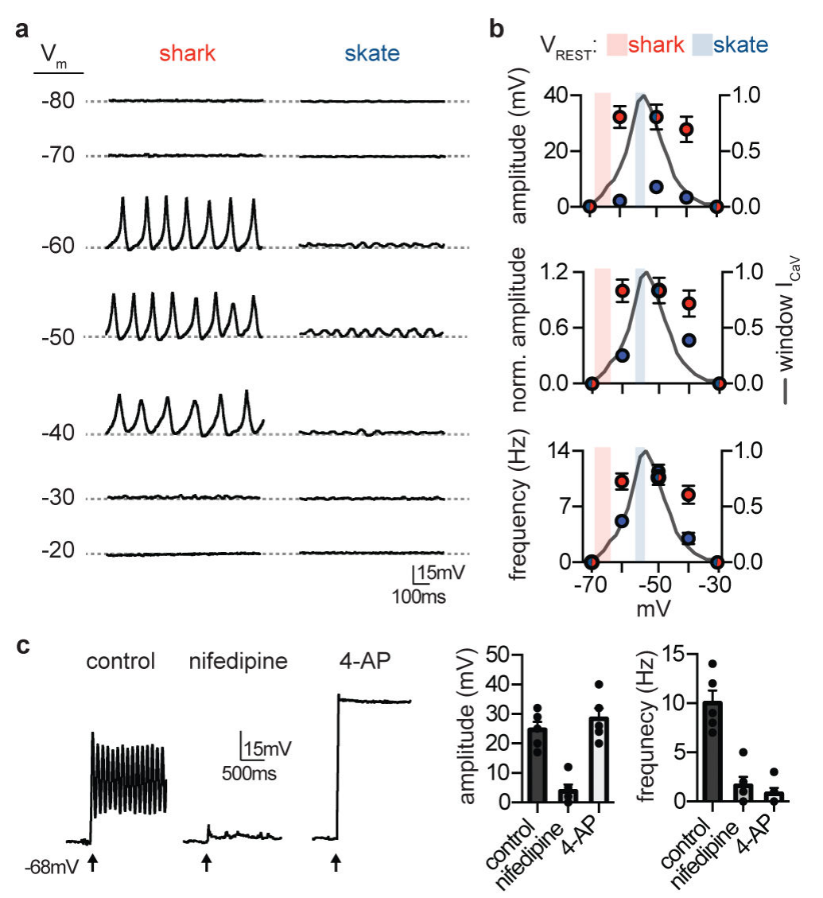
Shark cells spike while skate cells oscillate
Current clamp measures membrane voltage while current is injected to change the cell’s operating point. Bellono and colleagues compared shark and skate receptor activity across matched voltage ranges. Average resting voltage was approximately −66 mV in shark cells and −54 mV in skate cells.
Depolarizing shark cells into the calcium-current range triggered large repetitive voltage spikes. Skate cells generated smaller oscillations whose amplitude and frequency varied more strongly with membrane voltage. Nifedipine blocked shark depolarization, and 4-AP prevented or markedly slowed repolarization.
These receptor spikes are calcium-driven membrane events and should not be confused with sodium-dependent action potentials propagated by afferent nerves. The shared calcium mechanism and differing potassium feedback produce distinct cellular dynamics. Isolated-cell activity establishes a physiological difference, while its effect on natural stimulus discrimination requires synaptic and organismal tests.
Bellono et al. (2018), Fig. 3(a–c). Shark spikes and skate oscillations under current clamp.
Bellono et al. (2018), Fig. 1(g). Catshark receptor cells: CaV1.3 and KV1.3 transcripts.
Bellono et al. (2018); Bellono et al. (2017)
39
Notes:
• Current clamp measures membrane voltage while current is injected to change the cell’s operating point. Bellono and colleagues compared shark and skate receptor activity across matched voltage ranges. Average resting voltage was approximately −66 mV in shark cells and −54 mV in skate cells.
– The cells were placed at different membrane potentials by fixed current injection, rather than by changing the surrounding natural field. This controls the operating point and tests voltage-dependent dynamics directly. The same command can expose a different balance of inward and outward conductances in the two species.
• Depolarizing shark cells into the calcium-current range triggered large repetitive voltage spikes. Skate cells generated smaller oscillations whose amplitude and frequency varied more strongly with membrane voltage. Nifedipine blocked shark depolarization, and 4-AP prevented or markedly slowed repolarization.
• These receptor spikes are calcium-driven membrane events and should not be confused with sodium-dependent action potentials propagated by afferent nerves. The shared calcium mechanism and differing potassium feedback produce distinct cellular dynamics. Isolated-cell activity establishes a physiological difference, while its effect on natural stimulus discrimination requires synaptic and organismal tests.
References:
Bellono NW, Leitch DB, Julius D (2018). Molecular tuning of electroreception in sharks and skates. Nature 558(7708):122-126. https://doi.org/10.1038/s41586-018-0160-9
Bellono NW, Leitch DB, Julius D (2017). Molecular basis of ancestral vertebrate electroreception. Nature 543(7645):391-396. https://doi.org/10.1038/nature21401
Figure: Bellono et al. (2018), Fig. 3(a–c). Shark spikes and skate oscillations under current clamp.
Figure source: https://doi.org/10.1038/s41586-018-0160-9
Figure: Bellono et al. (2018), Fig. 1(g). Catshark receptor cells: CaV1.3 and KV1.3 transcripts.
Figure source: https://doi.org/10.1038/s41586-018-0160-9

Slide 40
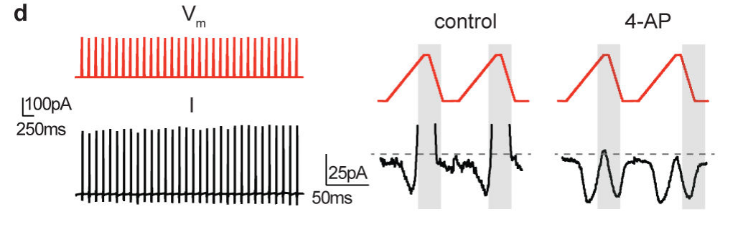
Sequential currents support repetitive shark spikes
Bellono and colleagues imposed voltage commands resembling recorded shark receptor spikes while measuring ionic currents. This protocol tested whether the identified currents could follow the timing of actual membrane activity. Inward calcium current preceded outward potassium current during the repeated commands.
At approximately −65 mV, calcium current was small; depolarization increased it before higher-voltage potassium activation opposed the inward flow. 4-AP removed the outward component and exposed renewed calcium current during the return toward negative voltage. Both conductances remained available across repeated cycles.
The measured sequence supports calcium-driven depolarization followed by KV-mediated repolarization, with rapidly closing potassium channels allowing another depolarizing cycle. The applied waveform was an experimental command reported by the paper, not proof of every process generating a spontaneous spike. Calcium buffering and accessory proteins may also regulate the native response.
Bellono et al. (2018), Fig. 3(d). Calcium and potassium currents during voltage-spike commands.
Bellono et al. (2018), Fig. 1(g). Catshark receptor cells: CaV1.3 and KV1.3 transcripts.
Bellono et al. (2018); Bellono et al. (2017)
40
Notes:
• Bellono and colleagues imposed voltage commands resembling recorded shark receptor spikes while measuring ionic currents. This protocol tested whether the identified currents could follow the timing of actual membrane activity. Inward calcium current preceded outward potassium current during the repeated commands.
– A voltage-clamp command controls the membrane trajectory rather than allowing currents to determine it. Recording currents along that trajectory tests their timing and persistence. It is therefore complementary to current clamp, which records the voltage trajectory produced by the cell’s own conductances.
• At approximately −65 mV, calcium current was small; depolarization increased it before higher-voltage potassium activation opposed the inward flow. 4-AP removed the outward component and exposed renewed calcium current during the return toward negative voltage. Both conductances remained available across repeated cycles.
• The measured sequence supports calcium-driven depolarization followed by KV-mediated repolarization, with rapidly closing potassium channels allowing another depolarizing cycle. The applied waveform was an experimental command reported by the paper, not proof of every process generating a spontaneous spike. Calcium buffering and accessory proteins may also regulate the native response.
References:
Bellono NW, Leitch DB, Julius D (2018). Molecular tuning of electroreception in sharks and skates. Nature 558(7708):122-126. https://doi.org/10.1038/s41586-018-0160-9
Bellono NW, Leitch DB, Julius D (2017). Molecular basis of ancestral vertebrate electroreception. Nature 543(7645):391-396. https://doi.org/10.1038/nature21401
Figure: Bellono et al. (2018), Fig. 3(d). Calcium and potassium currents during voltage-spike commands.
Figure source: https://doi.org/10.1038/s41586-018-0160-9
Figure: Bellono et al. (2018), Fig. 1(g). Catshark receptor cells: CaV1.3 and KV1.3 transcripts.
Figure source: https://doi.org/10.1038/s41586-018-0160-9

Slide 41
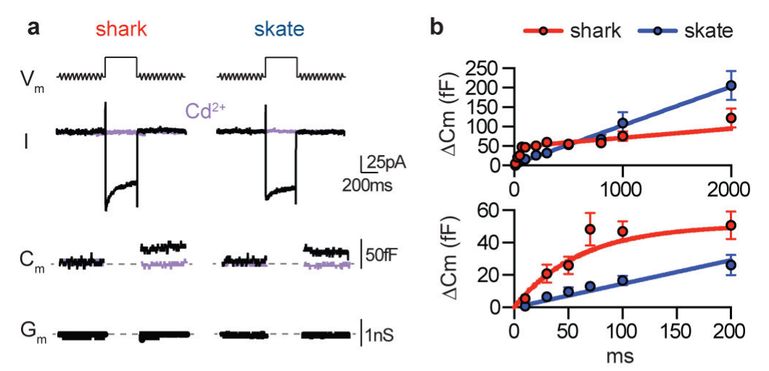
Calcium influx triggers vesicular membrane fusion
Bellono and colleagues measured membrane capacitance, the membrane’s ability to store charge, as a readout of synaptic-vesicle fusion. Fusion adds vesicle membrane to the cell surface. A 200-ms pulse to −20 mV elicited calcium current and a capacitance increase in both shark and skate receptors.
Cadmium blocked the inward current and capacitance change, supporting calcium-dependent release. Increasing stimulus duration produced larger release-associated responses, but shark responses approached saturation more rapidly; skate capacitance increased more steadily with duration. Membrane-conductance controls limited recording artifacts that could mimic capacitance changes.
The assay measures membrane addition associated with exocytosis rather than directly counting transmitter molecules or postsynaptic receptor openings. These papers did not determine the transmitter identity or receptor subtype from capacitance alone. Calcium entry and vesicle fusion are established steps; the downstream chemical response requires separate synaptic measurements.
Bellono et al. (2018), Fig. 4(a–b). Calcium-dependent capacitance changes during vesicle fusion.
Bellono et al. (2017), Fig. 1(c–d). Isolated ampulla and receptor cell.
Bellono et al. (2018); Bellono et al. (2017)
41
Notes:
• Bellono and colleagues measured membrane capacitance, the membrane’s ability to store charge, as a readout of synaptic-vesicle fusion. Fusion adds vesicle membrane to the cell surface. A 200-ms pulse to −20 mV elicited calcium current and a capacitance increase in both shark and skate receptors.
– Exocytosis means fusion of an intracellular vesicle with the plasma membrane. Cadmium is a calcium-channel pore blocker, so its effect links release to calcium entry under this protocol. A change in membrane conductance can interfere with capacitance estimates, making the reported conductance checks essential.
• Cadmium blocked the inward current and capacitance change, supporting calcium-dependent release. Increasing stimulus duration produced larger release-associated responses, but shark responses approached saturation more rapidly; skate capacitance increased more steadily with duration. Membrane-conductance controls limited recording artifacts that could mimic capacitance changes.
• The assay measures membrane addition associated with exocytosis rather than directly counting transmitter molecules or postsynaptic receptor openings. These papers did not determine the transmitter identity or receptor subtype from capacitance alone. Calcium entry and vesicle fusion are established steps; the downstream chemical response requires separate synaptic measurements.
References:
Bellono NW, Leitch DB, Julius D (2018). Molecular tuning of electroreception in sharks and skates. Nature 558(7708):122-126. https://doi.org/10.1038/s41586-018-0160-9
Bellono NW, Leitch DB, Julius D (2017). Molecular basis of ancestral vertebrate electroreception. Nature 543(7645):391-396. https://doi.org/10.1038/nature21401
Figure: Bellono et al. (2018), Fig. 4(a–b). Calcium-dependent capacitance changes during vesicle fusion.
Figure source: https://doi.org/10.1038/s41586-018-0160-9
Figure: Bellono et al. (2017), Fig. 1(c–d). Isolated ampulla and receptor cell.
Figure source: https://doi.org/10.1038/nature21401

Slide 42
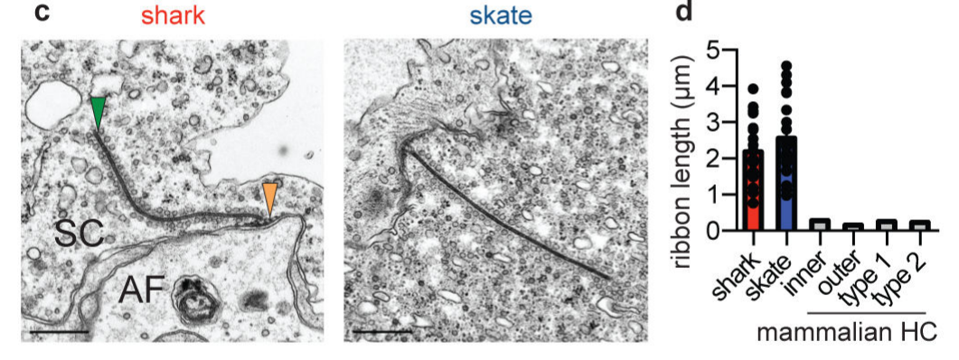
Ribbon synapses organize receptor-to-nerve output
A ribbon synapse contains an intracellular structure that tethers vesicles near the release membrane. Bellono and colleagues used electron microscopy to examine shark and skate receptor synapses. Both species contained unusually long ribbons associated with vesicles and postsynaptic afferent endings.
The ribbons had similar shapes and tethered vesicles of comparable size and number. Shark receptors contained a larger readily releasable vesicle pool, whereas skate receptors contained more free cytoplasmic vesicles. The anatomical comparison accompanied measurements of faster release saturation in shark cells and more sustained responses in skate cells.
Pool organization offers a plausible explanation for release dynamics, but morphology alone cannot assign every vesicle’s eventual fate. The proposed refilling role of free vesicles draws on comparison with other ribbon synapses. Electron microscopy establishes synaptic architecture while capacitance and current recordings test its functional output.
Bellono et al. (2018), Fig. 4(c–d). Electron microscopy of shark and skate ribbon synapses.
Bellono et al. (2018)
42
Notes:
• A ribbon synapse contains an intracellular structure that tethers vesicles near the release membrane. Bellono and colleagues used electron microscopy to examine shark and skate receptor synapses. Both species contained unusually long ribbons associated with vesicles and postsynaptic afferent endings.
– A readily releasable pool is positioned for rapid fusion, whereas a refilling pool can replenish release sites over time. The reported anatomical differences are compatible with these functional distinctions. They do not directly measure the recycling history or neurotransmitter content of every imaged vesicle.
• The ribbons had similar shapes and tethered vesicles of comparable size and number. Shark receptors contained a larger readily releasable vesicle pool, whereas skate receptors contained more free cytoplasmic vesicles. The anatomical comparison accompanied measurements of faster release saturation in shark cells and more sustained responses in skate cells.
• Pool organization offers a plausible explanation for release dynamics, but morphology alone cannot assign every vesicle’s eventual fate. The proposed refilling role of free vesicles draws on comparison with other ribbon synapses. Electron microscopy establishes synaptic architecture while capacitance and current recordings test its functional output.
References:
Bellono NW, Leitch DB, Julius D (2018). Molecular tuning of electroreception in sharks and skates. Nature 558(7708):122-126. https://doi.org/10.1038/s41586-018-0160-9
Figure: Bellono et al. (2018), Fig. 4(c–d). Electron microscopy of shark and skate ribbon synapses.
Figure source: https://doi.org/10.1038/s41586-018-0160-9

Slide 43
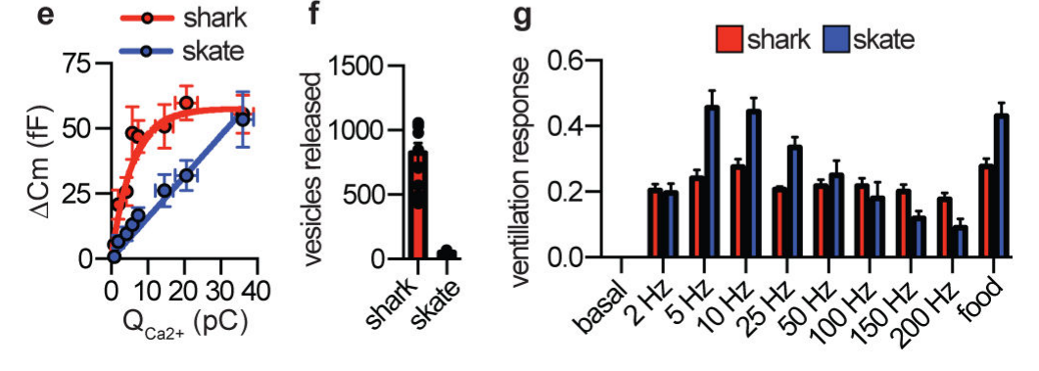
Cellular tuning parallels species-specific ventilation
Bellono and colleagues compared electrically evoked ventilation in chain catsharks and little skates, using equal-strength stimuli across frequencies. Ventilation is movement of water over the gills for gas exchange. Food odor supplied a comparison stimulus that verified a measurable response in both species.
Catsharks increased ventilation similarly across the tested electrical frequencies, whereas skates responded most strongly at lower frequencies. Cell measurements separately suggested at least tenfold greater vesicle release for a shark voltage spike than for a skate oscillation, based on calcium–capacitance relationships and vesicle-size estimates.
The physiological and organismal comparisons support broad threshold-like detection in sharks and more selective tuning in skates. The vesicle number is an estimate, and ventilation is not a prey-identification task. A causal explanation linking each channel adaptation to natural communication or predation remains proposed rather than fully established.
Bellono et al. (2018), Fig. 4(e–g). Calcium–release relationships and frequency-dependent ventilation.
Bellono et al. (2018)
43
Notes:
• Bellono and colleagues compared electrically evoked ventilation in chain catsharks and little skates, using equal-strength stimuli across frequencies. Ventilation is movement of water over the gills for gas exchange. Food odor supplied a comparison stimulus that verified a measurable response in both species.
– The estimated fusion difference used measured calcium charge, capacitance changes, and vesicle diameter, not direct visual counting during a spike. Equal maximal odor responses helped compare the two species’ ventilatory readout. Species-specific ecology is a hypothesis informed by these results, not an experimentally manipulated variable.
• Catsharks increased ventilation similarly across the tested electrical frequencies, whereas skates responded most strongly at lower frequencies. Cell measurements separately suggested at least tenfold greater vesicle release for a shark voltage spike than for a skate oscillation, based on calcium–capacitance relationships and vesicle-size estimates.
• The physiological and organismal comparisons support broad threshold-like detection in sharks and more selective tuning in skates. The vesicle number is an estimate, and ventilation is not a prey-identification task. A causal explanation linking each channel adaptation to natural communication or predation remains proposed rather than fully established.
References:
Bellono NW, Leitch DB, Julius D (2018). Molecular tuning of electroreception in sharks and skates. Nature 558(7708):122-126. https://doi.org/10.1038/s41586-018-0160-9
Figure: Bellono et al. (2018), Fig. 4(e–g). Calcium–release relationships and frequency-dependent ventilation.
Figure source: https://doi.org/10.1038/s41586-018-0160-9

Slide 44
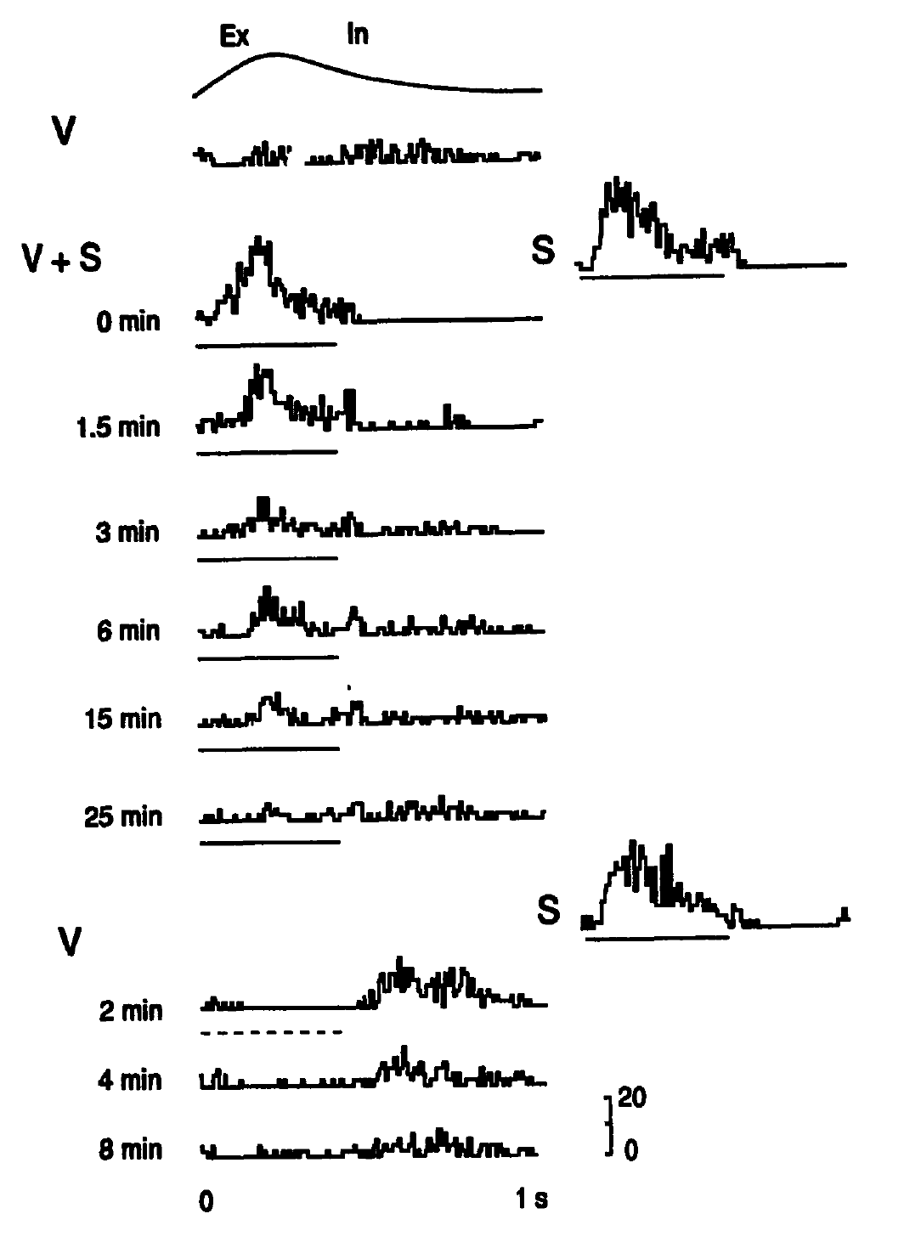
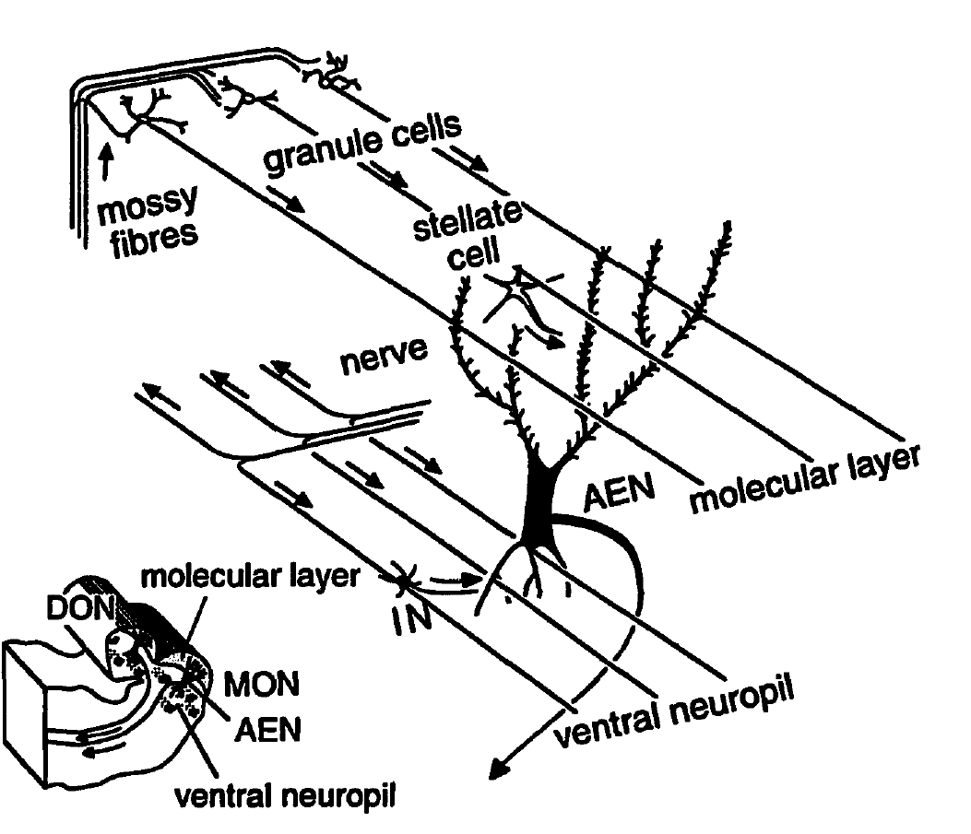
The hindbrain learns to cancel predictable self-input
Reafference is sensory stimulation caused by an animal’s own movement. Montgomery and Bodznick recorded ascending efferent neurons in the little skate’s dorsal octavolateralis nucleus, or DON, the first medullary electrosensory processing nucleus. Ventilation timing was measured with a force transducer near the gills.
A 2-µV dipole stimulus at the skin was repeatedly coupled to ventilation. Neural responses declined over minutes; uncoupled presentations still evoked responses. After 10 minutes of coupling, the mean reduction in responsive neurons was 44.3%. Turning the stimulus off revealed an opposite-sign cancellation response at the trained respiratory phase.
The controls distinguish learned temporal cancellation from generalized fatigue. Primary afferents contact basal dendrites, while cerebellar parallel fibers and inhibitory interneurons contact apical dendrites. Plasticity in this circuit was proposed to generate the cancellation signal; this experiment established adaptive filtering without identifying its complete synaptic learning rule or transmitter mechanism.
Montgomery & Bodznick (1994), Fig. 1. Ventilation-coupled stimulation induces adaptive cancellation.
Montgomery & Bodznick (1994), Fig. 3. Original published medullary anatomy.
Montgomery & Bodznick (1994)
44
Notes:
• Reafference is sensory stimulation caused by an animal’s own movement. Montgomery and Bodznick recorded ascending efferent neurons in the little skate’s dorsal octavolateralis nucleus, or DON, the first medullary electrosensory processing nucleus. Ventilation timing was measured with a force transducer near the gills.
– The animals were decerebrated and spinal cords transected, while natural ventilation continued. This reduced other movements but limits generalization to an intact hunting skate. Parallel fibers arise from cerebellar granule cells and can supply movement-related information to the same output neuron receiving electrical sensory input. When an expected signal is removed, the learned cancellation persists temporarily and becomes observable. The original article’s anatomical drawing is retained as a published source, not reconstructed.
• A 2-µV dipole stimulus at the skin was repeatedly coupled to ventilation. Neural responses declined over minutes; uncoupled presentations still evoked responses. After 10 minutes of coupling, the mean reduction in responsive neurons was 44.3%. Turning the stimulus off revealed an opposite-sign cancellation response at the trained respiratory phase.
• The controls distinguish learned temporal cancellation from generalized fatigue. Primary afferents contact basal dendrites, while cerebellar parallel fibers and inhibitory interneurons contact apical dendrites. Plasticity in this circuit was proposed to generate the cancellation signal; this experiment established adaptive filtering without identifying its complete synaptic learning rule or transmitter mechanism.
References:
Montgomery JC, Bodznick D (1994). An adaptive filter that cancels self-induced noise in the electrosensory and lateral line mechanosensory systems of fish. Neuroscience Letters 174(2):145-148. https://doi.org/10.1016/0304-3940(94)90007-8
Figure: Montgomery & Bodznick (1994), Fig. 1. Ventilation-coupled stimulation induces adaptive cancellation.
Figure source: https://doi.org/10.1016/0304-3940(94)90007-8
Figure: Montgomery & Bodznick (1994), Fig. 3. Original published medullary anatomy.
Figure source: https://doi.org/10.1016/0304-3940(94)90007-8

Slide 45
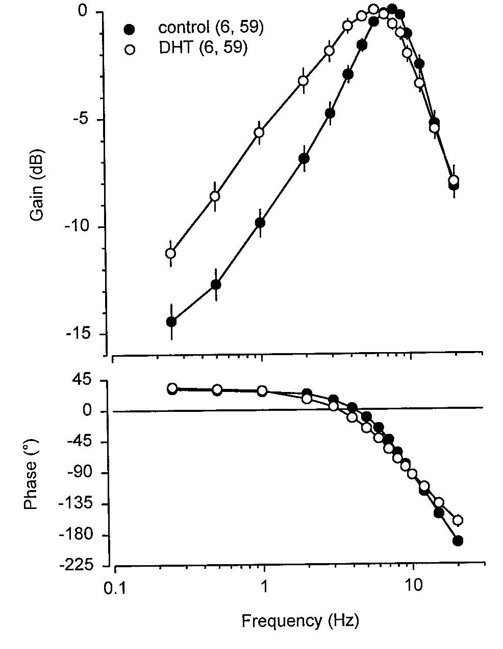
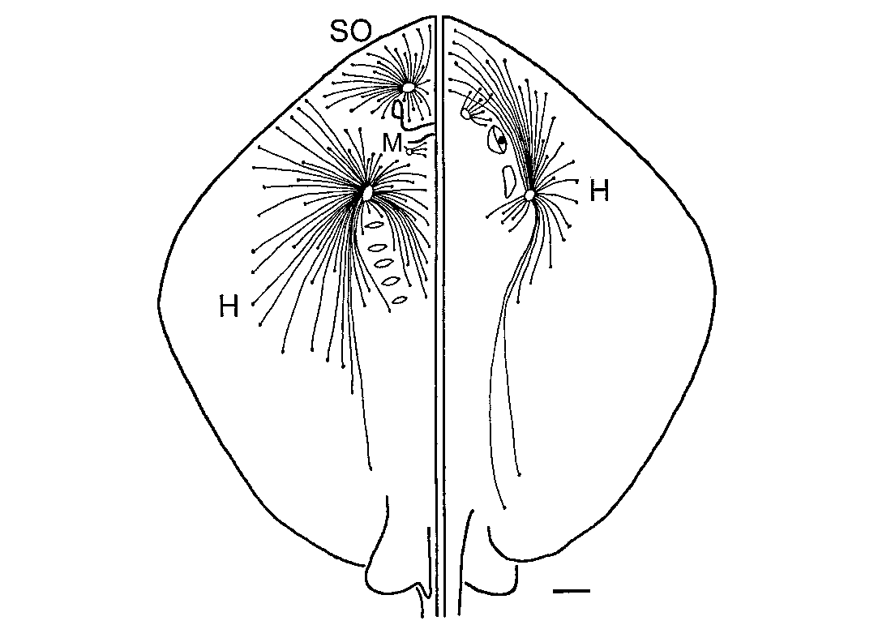
Androgen state alters afferent frequency tuning
Sisneros and Tricas implanted male Atlantic stingrays, Dasyatis sabina, with dihydrotestosterone, or DHT, an androgen hormone. Empty implants provided treatment controls. After 10–21 days, they recorded electrosensory afferents while varying the frequency of uniform electric-field stimulation.
Control afferents had peak sensitivity near 7–8 Hz, compared with approximately 5–6 Hz after DHT treatment. Responses from 0.5 to 4 Hz were approximately 2–4 dB higher in treated animals. Canal-group comparisons associated different tuning patterns with receptor anatomy and canal length.
The manipulation establishes hormonal modulation of peripheral sensory coding rather than a fixed species-wide frequency filter. The study did not identify the specific androgen-regulated channel or prove improved mating performance. Ecological tuning to conspecific ventilation is supported as an interpretation, while the recorded frequency shift is directly experimental.
Sisneros & Tricas (2000), Fig. 6. Androgen treatment shifts afferent frequency response.
Sisneros & Tricas (2000), Fig. 9. Ampullary canal distribution.
Sisneros & Tricas (2000)
45
Notes:
• Sisneros and Tricas implanted male Atlantic stingrays, Dasyatis sabina, with dihydrotestosterone, or DHT, an androgen hormone. Empty implants provided treatment controls. After 10–21 days, they recorded electrosensory afferents while varying the frequency of uniform electric-field stimulation.
– An androgen is a steroid hormone involved in reproductive state. Empty capsules controlled the implantation procedure, and the experiments distinguished short and long canal groups. Differences from round-stingray and little-skate results should preserve species, hormone state, canal identity, and preparation rather than be merged into one universal best frequency.
• Control afferents had peak sensitivity near 7–8 Hz, compared with approximately 5–6 Hz after DHT treatment. Responses from 0.5 to 4 Hz were approximately 2–4 dB higher in treated animals. Canal-group comparisons associated different tuning patterns with receptor anatomy and canal length.
• The manipulation establishes hormonal modulation of peripheral sensory coding rather than a fixed species-wide frequency filter. The study did not identify the specific androgen-regulated channel or prove improved mating performance. Ecological tuning to conspecific ventilation is supported as an interpretation, while the recorded frequency shift is directly experimental.
References:
Sisneros JA, Tricas TC (2000). Androgen-Induced Changes in the Response Dynamics of Ampullary Electrosensory Primary Afferent Neurons. The Journal of Neuroscience 20(22):8586-8595. https://doi.org/10.1523/jneurosci.20-22-08586.2000
Figure: Sisneros & Tricas (2000), Fig. 6. Androgen treatment shifts afferent frequency response.
Figure source: https://doi.org/10.1523/jneurosci.20-22-08586.2000
Figure: Sisneros & Tricas (2000), Fig. 9. Ampullary canal distribution.
Figure source: https://doi.org/10.1523/JNEUROSCI.20-22-08586.2000

Slide 46
Key takeaways
Electrical guidance is experimentally isolated Conductive agar preserves attacks, insulation blocks them, and active dipoles restore directed feeding independently of target odor.
Sensitivity depends on geometry and sampling Nanovolt-gradient responses require source geometry, encounter angle and movement to be distinguished from cellular voltage thresholds.
Receptors amplify weak inputs Low-threshold CaV1.3 supports calcium entry; BK feedback in skates and KV1.3 feedback in catsharks produce distinct membrane dynamics.
Sequence changes alter channel function Neutralization and reciprocal mutations causally link particular CaV1.3 and BK residues to activation, conductance and opening behavior.
Synapses transform cellular activity into output Calcium-dependent ribbon-synapse release differs between shark and skate receptors; vesicle estimates and ventilation do not alone prove ecological function.
Sensory coding is adaptable Afferents saturate and adapt; hindbrain filtering cancels ventilation-linked input, and androgen treatment changes peripheral frequency tuning.
Kalmijn (1971); Bellono et al. (2017, 2018); Montgomery & Bodznick (1994)
46
Notes:
• Electrical guidance is experimentally isolated. Conductive agar preserves attacks, insulation blocks them, and active dipoles restore directed feeding independently of target odor.
• Sensitivity depends on geometry and sampling. Nanovolt-gradient responses require source geometry, encounter angle and movement to be distinguished from cellular voltage thresholds.
• Receptors amplify weak inputs. Low-threshold CaV1.3 supports calcium entry; BK feedback in skates and KV1.3 feedback in catsharks produce distinct membrane dynamics.
• Sequence changes alter channel function. Neutralization and reciprocal mutations causally link particular CaV1.3 and BK residues to activation, conductance and opening behavior.
• Synapses transform cellular activity into output. Calcium-dependent ribbon-synapse release differs between shark and skate receptors; vesicle estimates and ventilation do not alone prove ecological function.
• Sensory coding is adaptable. Afferents saturate and adapt; hindbrain filtering cancels ventilation-linked input, and androgen treatment changes peripheral frequency tuning.
References:
Kalmijn AJ (1971). The Electric Sense of Sharks and Rays. Journal of Experimental Biology 55(2):371-383. https://doi.org/10.1242/jeb.55.2.371
Kajiura SM, Holland KN (2002). Electroreception in juvenile scalloped hammerhead and sandbar sharks. Journal of Experimental Biology 205(23):3609-3621. https://doi.org/10.1242/jeb.205.23.3609
Tricas TC, New JG (1998). Sensitivity and response dynamics of elasmobranch electrosensory primary afferent neurons to near threshold fields. Journal of Comparative Physiology A: Sensory, Neural, and Behavioral Physiology 182(1):89-101. https://doi.org/10.1007/s003590050161
Bellono NW, Leitch DB, Julius D (2017). Molecular basis of ancestral vertebrate electroreception. Nature 543(7645):391-396. https://doi.org/10.1038/nature21401
Bellono NW, Leitch DB, Julius D (2018). Molecular tuning of electroreception in sharks and skates. Nature 558(7708):122-126. https://doi.org/10.1038/s41586-018-0160-9
Montgomery JC, Bodznick D (1994). An adaptive filter that cancels self-induced noise in the electrosensory and lateral line mechanosensory systems of fish. Neuroscience Letters 174(2):145-148. https://doi.org/10.1016/0304-3940(94)90007-8
Sisneros JA, Tricas TC (2000). Androgen-Induced Changes in the Response Dynamics of Ampullary Electrosensory Primary Afferent Neurons. The Journal of Neuroscience 20(22):8586-8595. https://doi.org/10.1523/jneurosci.20-22-08586.2000

