Slide 1
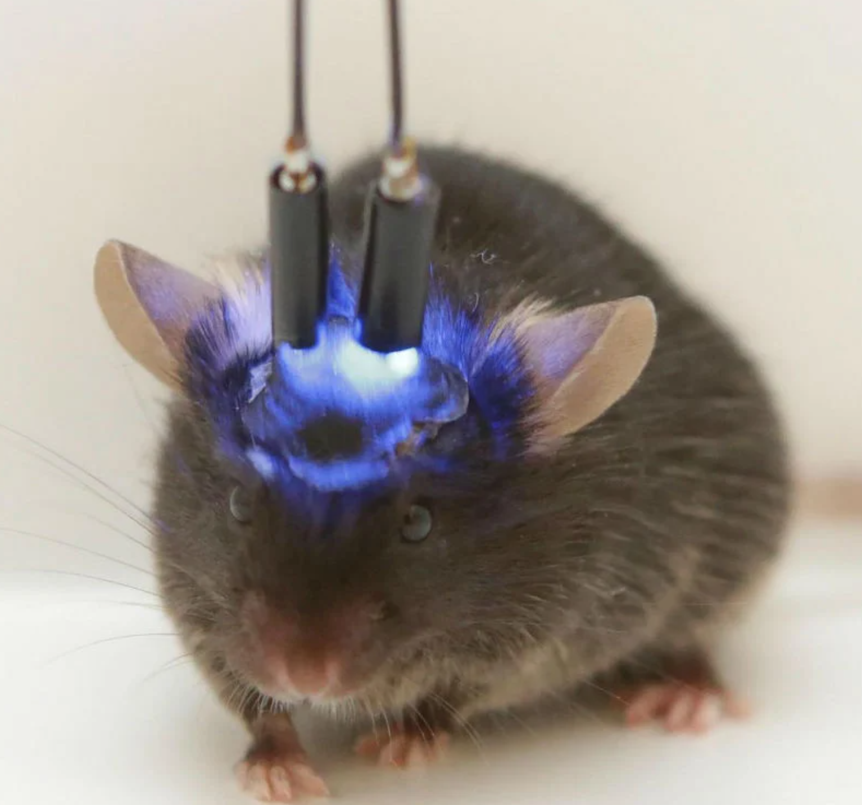
NEUR 411 · NEUROETHOLOGY · FALL 2026
Lecture 40
Frontiers:
optogenetics, wireless-recording tools in emerging neuroethology systems, and casual tests of neural circuits underlying natural behavior
Friday, December 4, 2026
Jordan Lopez, Ph.D.
Professor of Neurobiology & Biomedical Engineering
Photo: Optogenetic stimulation in a mouse; blue light through implanted fibers activates targeted neurons.
Notes:
Frontiers: optogenetics, wireless-recording tools in emerging neuroethology systems, and casual tests of neural circuits underlying natural behavior
Lecture 40. NEUR 411 · NEUROETHOLOGY · FALL 2026. Friday, December 4, 2026.
Figure: Bezares-Calderón et al. (2018), Fig. 1(A). Nectochaete larva of Platynereis dumerilii.
Figure source: https://doi.org/10.7554/elife.36262
References:
Luis A Bezares-Calderón; Jürgen Berger; Sanja Jasek; Csaba Verasztó; Sara Mendes; Martin Gühmann; Rodrigo Almeda; Réza Shahidi; Gáspár Jékely (2018). Neural circuitry of a polycystin-mediated hydrodynamic startle response for predator avoidance. eLife 7: e36262. https://doi.org/10.7554/elife.36262

Slide 2
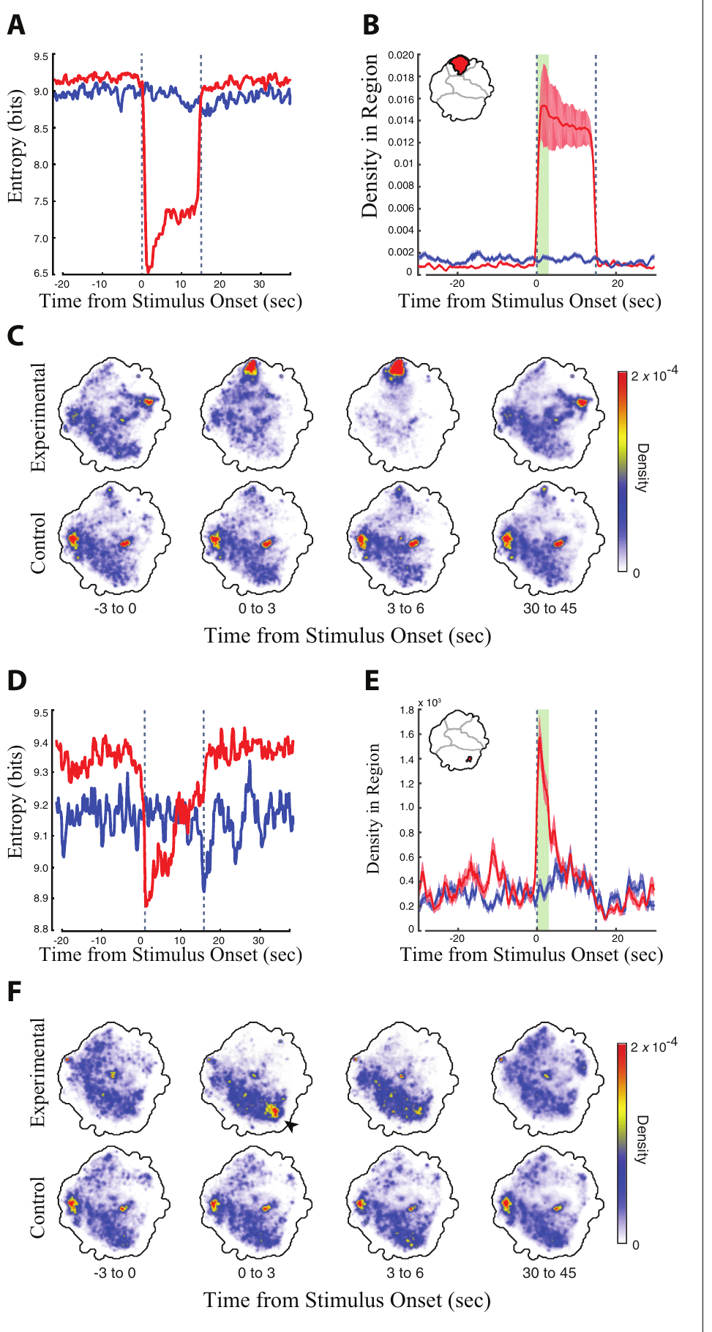
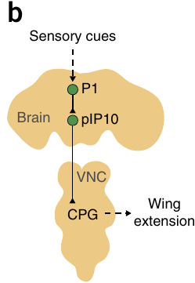
Optical activation can recruit a specific action
Optogenetics gives control over cell activity by making selected cells express a light-sensitive protein. A descending neuron relays signals from the brain to the ventral nerve cord, a longitudinal structure with motor networks that organize movement. Cande and colleagues placed the light-gated channel CsChrimson into identified descending neurons of adult flies.
Flies received 15 s pulses of red light separated by 45 s recovery periods. Flies fed retinal, the light-absorbing cofactor the channel needs, raised how often they occupied particular grooming or locomotor behaviors. Genetically matched flies without the cofactor served as the control for the light itself.
Sufficiency means that activating the tested cells can produce a response under the assay conditions. A proposed circuit arrangement by Inagaki and colleagues places the courtship interneuron P1 upstream of the descending population pIP10, which links optical input to a defined motor output in that proposed pathway.
Inagaki et al. (2014), Fig. 3(b). Published P1 and pIP10 circuit arrangement; connectivity is proposed.
Cande et al. (2018), Fig. 2(A–F). Grooming occupancy and entropy during 15-s stimulation.
Cande et al. (2018); Inagaki et al. (2014)
02
Notes:
• Optogenetics changes cellular activity by expressing a light-sensitive protein in selected cells. A descending neuron carries signals from the brain toward the ventral nerve cord, a longitudinal nervous-system structure whose motor networks organize movement. Cande and colleagues expressed the light-gated channel CsChrimson in identified descending-neuron populations of adult flies.
• Flies received 15-s pulses of red light separated by 45-s recovery periods. Retinal-fed experimental flies increased occupancy of particular grooming or locomotor behaviors, whereas genetically matched flies without supplemental retinal supplied a stimulation control. Retinal is the light-absorbing cofactor required by the channel.
– The fly can move within its chamber during stimulation. A behavioral change is attributed to the light-sensitive cells only after comparing it with flies that experience the same illumination but lack the supplied cofactor. The published P1–pIP10 arrangement identifies a brain-to-nerve-cord pathway; it is a separate courtship example, not the anatomical identity of the grooming cells.
• Recruiting a particular action establishes sufficiency: activating the tested cells can produce that response under the assay conditions. It does not establish that those cells normally initiate every occurrence of the behavior, or that the artificially imposed activity matches their natural firing pattern.
References:
Jessica Cande; Shigehiro Namiki; Jirui Qiu; Wyatt Korff; Gwyneth M Card; Joshua W Shaevitz; David L Stern; Gordon J Berman (2018). Optogenetic dissection of descending behavioral control in Drosophila. eLife 7: e34275. https://doi.org/10.7554/elife.34275
Hidehiko K Inagaki; Yonil Jung; Eric D Hoopfer; Allan M Wong; Neeli Mishra; John Y Lin; Roger Y Tsien; David J Anderson (2014). Optogenetic control of Drosophila using a red-shifted channelrhodopsin reveals experience-dependent influences on courtship. Nature Methods 11(3): 325-332. https://doi.org/10.1038/nmeth.2765
Figure: Cande et al. (2018), Fig. 2(A–F). Grooming occupancy and entropy during 15-s stimulation.
Figure source: https://doi.org/10.7554/elife.34275
Figure: Inagaki et al. (2014), Fig. 3(b). Published P1 and pIP10 circuit arrangement; connectivity is proposed.
Figure source: https://doi.org/10.1038/nmeth.2765

Slide 3
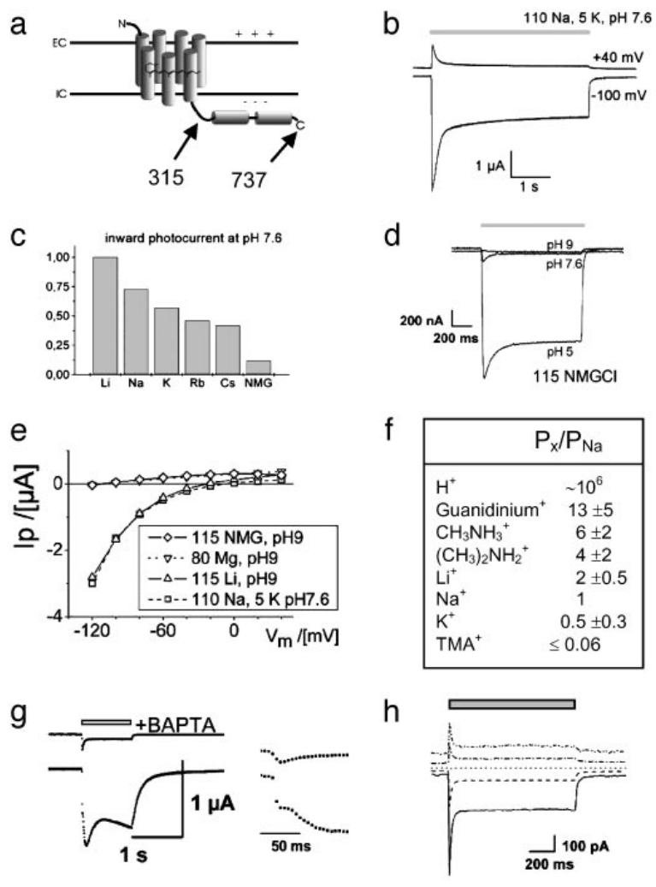
A microbial channel directly couples light to current
Channelrhodopsin-2, or ChR2, is a membrane protein from the green alga Chlamydomonas reinhardtii that contains retinal. Its ion channel forms a pathway for charged particles to cross the membrane. Nagel and colleagues expressed ChR2 in frog oocytes and mammalian cells to learn what the protein does when light reaches it.
Illumination near 450 nm produced currents that were missing from uninjected oocytes. Voltage clamp holds the membrane at a chosen voltage while an amplifier measures the current. Changing the held voltage changed the size and direction of the current, a pattern that fits a passive conductance rather than an ion pump.
A truncated construct containing the first 315 amino acids kept its channel function. The light-gated conductance therefore sits within the membrane-spanning portion of the protein, which forms the pathway for charged particles. The protein carries the current itself rather than relaying it through another molecule.
Nagel et al. (2003), Fig. 1(a–h). Original ChR2 currents under ion substitution and voltage clamp.
Nagel et al. (2003)
03
Notes:
• Channelrhodopsin-2, or ChR2, is a retinal-containing membrane protein from the green alga Chlamydomonas reinhardtii. An ion channel provides a pathway through which charged particles move across the membrane. Nagel and colleagues expressed ChR2 in frog oocytes and mammalian cells to determine its primary action.
• Blue illumination near 450 nm produced currents absent from uninjected oocytes. Under voltage clamp, an amplifier holds membrane voltage at a selected value while measuring current. Changing the held voltage changed current magnitude and direction, supporting a passive conductance rather than an ion pump.
– An oocyte is an immature egg cell large enough for controlled electrical recordings. Expressing the same protein in more than one host helps separate its own function from a specialized component of the original algal sensory system. Passive ion movement follows electrical and concentration gradients rather than transporting a fixed ion number per photon.
• A truncated construct containing the first 315 amino acids retained channel function. The findings locate the light-gated conductance within the membrane-spanning portion of the protein. They establish a cellular mechanism in expression systems, rather than a causal role for ChR2 in an animal’s natural behavioral circuit.
References:
Georg Nagel; Tanjef Szellas; Wolfram Huhn; Suneel Kateriya; Nona Adeishvili; Peter Berthold; Doris Ollig; Peter Hegemann; Ernst Bamberg (2003). Channelrhodopsin-2, a directly light-gated cation-selective membrane channel. Proceedings of the National Academy of Sciences 100(24): 13940-13945. https://doi.org/10.1073/pnas.1936192100
Figure: Nagel et al. (2003), Fig. 1(a–h). Original ChR2 currents under ion substitution and voltage clamp.
Figure source: https://doi.org/10.1073/pnas.1936192100

Slide 4
ChR2 conducts light-driven current directly
Channelrhodopsin-2 is a retinal-containing protein from the green alga Chlamydomonas reinhardtii. When blue light near 450 nm reached ChR2-expressing frog oocytes, it produced a current that uninjected oocytes lacked, which showed that the protein itself carries the response to light.
Voltage clamp holds the membrane at a chosen voltage while the amplifier records the current that flows. Changing the held voltage altered the size and direction of the light-evoked current, a pattern that fits a passive conductance rather than an ion pump. Current direction therefore depends on the voltage at which the membrane is held.
A truncated protein containing the first 315 amino acids kept its channel function. The light-gated conductance therefore lies within the membrane-spanning portion of the protein, the part that forms the pathway for charged particles. That region alone is sufficient to carry the light-gated current.
Nagel et al. (2003), Fig. 1(a–h). Original ChR2 currents under ion substitution and voltage clamp.
Nagel et al. (2003)
03a
Notes:
• ChR2 conducts light-driven current directly.
• Explanation 1.
– Channelrhodopsin-2 is a retinal-containing protein from the green alga Chlamydomonas reinhardtii
– When blue light near 450 nm reached ChR2-expressing frog oocytes, it produced a current that uninjected oocytes lacked, which showed that the protein itself carries the response to light.
• Explanation 2.
– Voltage clamp holds the membrane at a chosen voltage while the amplifier records the current that flows
– Changing the held voltage altered the size and direction of the light-evoked current, a pattern that fits a passive conductance rather than an ion pump. Current direction therefore depends on the voltage at which the membrane is held.
• Explanation 3.
– A truncated protein containing the first 315 amino acids kept its channel function
– The light-gated conductance therefore lies within the membrane-spanning portion of the protein, the part that forms the pathway for charged particles. That region alone is sufficient to carry the light-gated current.
• Expression.
– Blue light near 450 nm produced a current in ChR2-expressing oocytes.
– Uninjected oocytes showed no such current.
– The protein carries the response itself.
• Clamp.
– Voltage clamp held the membrane at chosen voltages.
– The current changed size and direction with the held voltage.
– That pattern fits a passive conductance.
• Truncation.
– The first 315 amino acids kept channel function.
– The light-gated conductance lies in the membrane-spanning region.
• Field setting.
– The experiments used expression systems, not intact animals.
– They identify a cellular mechanism.
References:
Georg Nagel; Tanjef Szellas; Wolfram Huhn; Suneel Kateriya; Nona Adeishvili; Peter Berthold; Doris Ollig; Peter Hegemann; Ernst Bamberg (2003). Channelrhodopsin-2, a directly light-gated cation-selective membrane channel. Proceedings of the National Academy of Sciences 100(24): 13940-13945. https://doi.org/10.1073/pnas.1936192100

Slide 5
Ion substitution identifies the channel’s selectivity
Ion selectivity sets which charged species a channel admits. Nagel and colleagues replaced the external salts around ChR2-expressing oocytes while measuring the response to the same blue light. Cations carry positive charge, and anions carry negative charge.
Photocurrents depended on the cation available in the solution. Replacing external chloride with aspartate left the current and its reversal voltage almost unchanged. The reversal voltage is the membrane voltage at which the net current changes direction. Calcium passed through ChR2, while magnesium permeated the channel to a negligible degree.
At pH 9, a small current remained in a solution containing the bulky cation N-methyl-D-glucamine, and that remnant disappeared. Its loss identified a proton contribution at lower pH. Together these substitution controls support cation conduction through the channel.
Nagel et al. (2003), Fig. 1(a–h). Currents and selectivity under controlled salt solutions.
Nagel et al. (2003)
04
Notes:
• Ion selectivity describes which charged species can pass through a channel. Nagel and colleagues replaced salts around ChR2-expressing oocytes while measuring the response to the same blue-light stimulation. Cations carry positive charge; anions carry negative charge.
• Photocurrents varied with the available cation. Replacing external chloride with aspartate did not appreciably change the current or its reversal voltage. Reversal voltage is the membrane voltage at which the net measured current changes direction. Calcium could also pass through ChR2, whereas magnesium permeability was negligible under the tested conditions.
– Changing one solution component at a time asks which ion is responsible for the current. Protons are hydrogen ions, and pH expresses their availability. Calcium entry also activated a native oocyte current; suppressing that secondary response with a calcium-binding compound helped isolate the channel’s own calcium permeability.
• At pH 9, with pH measuring acidity, the small current remaining in a solution containing the bulky cation N-methyl-D-glucamine disappeared, identifying a proton contribution at lower pH. These substitution controls support cation conduction. They do not justify assuming identical currents in neurons with different intracellular ion concentrations or membrane voltages.
References:
Georg Nagel; Tanjef Szellas; Wolfram Huhn; Suneel Kateriya; Nona Adeishvili; Peter Berthold; Doris Ollig; Peter Hegemann; Ernst Bamberg (2003). Channelrhodopsin-2, a directly light-gated cation-selective membrane channel. Proceedings of the National Academy of Sciences 100(24): 13940-13945. https://doi.org/10.1073/pnas.1936192100
Figure: Nagel et al. (2003), Fig. 1(a–h). Currents and selectivity under controlled salt solutions.
Figure source: https://doi.org/10.1073/pnas.1936192100

Slide 6
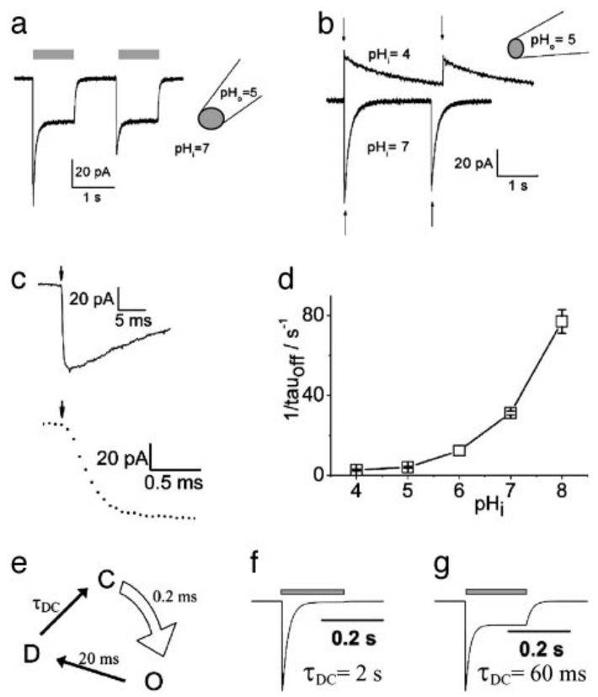
Excised membranes retain rapid light gating
A light-evoked current could come from the expressed protein itself or from a signaling pathway that opens a different channel. Nagel and colleagues recorded ChR2 in excised membrane patches, membrane fragments removed from the cell so that the internal solution could be controlled.
Photocurrents persisted after the soluble contents of the cell were replaced. A 10 ns laser flash opened the channel with a rise time of about 200 µs or faster. Closing was much slower and depended on intracellular pH, taking roughly 10 to 400 ms across the conditions tested.
Rapid opening and persistent current support direct gating, in which light opens the channel without a diffusible messenger inside the cell. The slower closing means that the electrical response can outlast the light pulse, because the closing rate depends on intracellular pH.
Nagel et al. (2003), Fig. 3(a–g). Excised-patch responses to light and intracellular pH.
Nagel et al. (2003)
05
Notes:
• A light-evoked current could arise either from the expressed protein itself or from a signaling pathway that activates another channel. Nagel and colleagues recorded ChR2 in excised membrane patches, membrane fragments separated from the intact cell with their internal solution experimentally controlled.
• Photocurrents remained after soluble cellular contents were replaced. A 10-ns laser flash triggered channel opening with a rise time near 200 µs or faster. Closing was much slower and depended on intracellular pH, spanning approximately 10–400 ms across the tested conditions.
– An inside-out patch exposes the membrane’s former cytoplasmic surface to the bathing solution. Manipulating that side of the membrane tests whether soluble cytoplasmic components are required and permits independent control of internal acidity. Rapid opening and pH-dependent closing are separate features of the measured response.
• The persistence and rapid onset support direct channel gating without a required diffusible intracellular messenger. The unequal opening and closing times also mean that light-pulse duration alone does not define the complete electrical response. These kinetics describe ChR2 in this preparation, not every subsequent channelrhodopsin variant.
References:
Georg Nagel; Tanjef Szellas; Wolfram Huhn; Suneel Kateriya; Nona Adeishvili; Peter Berthold; Doris Ollig; Peter Hegemann; Ernst Bamberg (2003). Channelrhodopsin-2, a directly light-gated cation-selective membrane channel. Proceedings of the National Academy of Sciences 100(24): 13940-13945. https://doi.org/10.1073/pnas.1936192100
Figure: Nagel et al. (2003), Fig. 3(a–g). Excised-patch responses to light and intracellular pH.
Figure source: https://doi.org/10.1073/pnas.1936192100

Slide 7
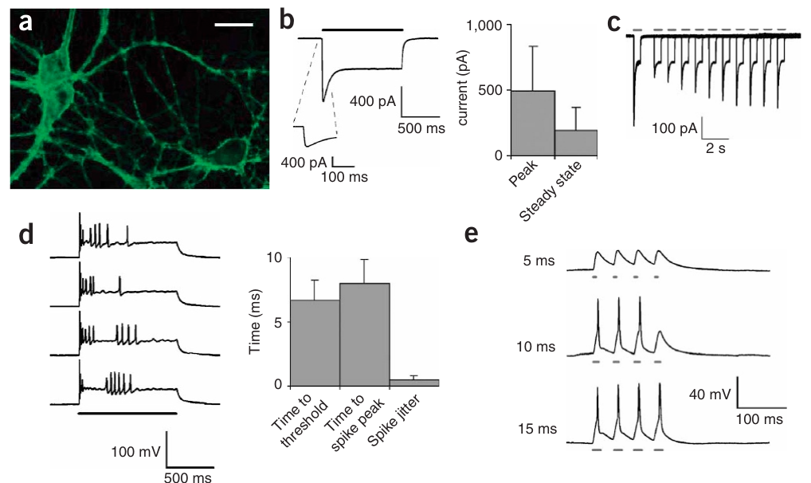
Membrane expression enables optical drive of neurons
Boyden and colleagues delivered a ChR2 fusion with yellow fluorescent protein into cultured rat neurons, using a lentiviral vector, a modified virus that carries the expression construct. The fluorescent tag marked the expressing cells and the membrane-associated processes that extend from them.
Blue light between 450 and 490 nm generated an average peak inward current near 496 pA, followed by a smaller sustained current near 193 pA. Neurons carrying the fluorescent tag alone gave no light-evoked response, so the electrical effect came from the channel rather than from fluorescence or illumination.
Inward current depolarizes the neuron, making its internal voltage less negative. When that voltage reaches firing threshold, the neuron produces an action potential, a rapid regenerative change in membrane voltage. Light therefore drives spikes in an expressing cell without requiring knowledge of its natural synaptic targets.
Boyden et al. (2005), Fig. 1(a–e). Membrane expression, inward current and light-evoked spikes.
Boyden et al. (2005)
06
Notes:
• Boyden and colleagues introduced a ChR2 fusion with yellow fluorescent protein into cultured rat neurons using a lentiviral vector, a modified virus that delivers an expression construct. The fluorescent tag identified the expressing cells and their membrane-associated processes.
• Blue light spanning 450–490 nm generated an average peak inward current near 496 pA, followed by a smaller sustained current near 193 pA. Neurons expressing the fluorescent tag alone did not produce light-evoked responses. These controls separate the channel’s electrical effect from fluorescence labeling and illumination.
– A picoampere is one trillionth of an ampere and expresses the current measured by the recording amplifier. The fluorescent signal locates the introduced protein but does not establish that every labeled process produces an equal photocurrent. The electrical measurement verifies that the expression construct can actually change membrane excitation.
• Inward current depolarized the neuron, making its internal voltage less negative. Reaching firing threshold triggered an action potential, a rapid regenerative voltage change. A synapse is a contact that transmits signals between cells. Expression permits intervention without identifying the cell’s natural targets or behavioral function.
References:
Edward S Boyden; Feng Zhang; Ernst Bamberg; Georg Nagel; Karl Deisseroth (2005). Millisecond-timescale, genetically targeted optical control of neural activity. Nature Neuroscience 8(9): 1263-1268. https://doi.org/10.1038/nn1525
Figure: Boyden et al. (2005), Fig. 1(a–e). Membrane expression, inward current and light-evoked spikes.
Figure source: https://doi.org/10.1038/nn1525

Slide 8
Membrane expression enables optical spiking
Boyden and colleagues delivered a ChR2 fusion with yellow fluorescent protein into cultured rat neurons using a lentiviral vector. The fluorescent tag marked the expressing cells and the membrane-associated processes that extend from them. The lentiviral vector is a modified virus that carries the expression construct into the cells.
Blue light between 450 and 490 nm generated an average peak inward current near 496 pA, followed by a smaller sustained current near 193 pA. Neurons carrying the fluorescent tag alone gave no light-evoked response, so the electrical effect came from the channel rather than from fluorescence or illumination.
Inward current depolarizes the neuron, and when the voltage reaches firing threshold, the neuron produces an action potential. Light therefore drives spikes in an expressing cell without requiring knowledge of its natural synaptic targets. The current is an inward flow that makes the internal voltage less negative.
Boyden et al. (2005), Fig. 1(a–e). Membrane expression, inward current and light-evoked spikes.
Boyden et al. (2005)
06a
Notes:
• Membrane expression enables optical spiking.
• Explanation 1.
– Boyden and colleagues delivered a ChR2 fusion with yellow fluorescent protein into cultured rat neurons using a lentiviral vector
– The fluorescent tag marked the expressing cells and the membrane-associated processes that extend from them. The lentiviral vector is a modified virus that carries the expression construct into the cells.
• Explanation 2.
– Blue light between 450 and 490 nm generated an average peak inward current near 496 pA, followed by a smaller sustained current near 193 pA
– Neurons carrying the fluorescent tag alone gave no light-evoked response, so the electrical effect came from the channel rather than from fluorescence or illumination.
• Explanation 3.
– Inward current depolarizes the neuron, and when the voltage reaches firing threshold, the neuron produces an action potential
– Light therefore drives spikes in an expressing cell without requiring knowledge of its natural synaptic targets. The current is an inward flow that makes the internal voltage less negative.
• Expression.
– A ChR2 fusion with yellow fluorescent protein was delivered into cultured rat neurons.
– The fluorescent tag marked the expressing cells.
• Current.
– Blue light produced an average peak inward current near 496 pA.
– A smaller sustained current near 193 pA followed.
• Control.
– Neurons with the tag alone gave no light-evoked response.
– The effect therefore came from the channel itself.
• Spikes.
– Inward current made the internal voltage less negative.
– Threshold triggered an action potential.
• Field setting.
– The neurons were cultured, not in an intact animal.
– The result concerns expression in a dish.
References:
Edward S Boyden; Feng Zhang; Ernst Bamberg; Georg Nagel; Karl Deisseroth (2005). Millisecond-timescale, genetically targeted optical control of neural activity. Nature Neuroscience 8(9): 1263-1268. https://doi.org/10.1038/nn1525

Slide 9
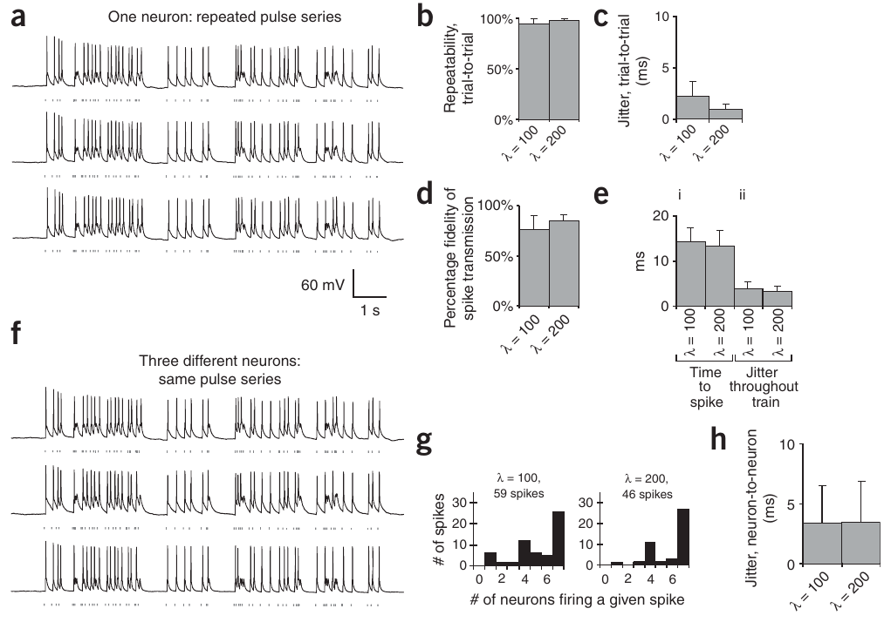
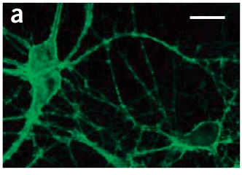
Pulse timing controls spikes with finite reliability
An action potential is a brief regenerative shift in membrane voltage that conveys a neuron's signal. Boyden and colleagues recorded neurons during repeated 10 to 15 ms light pulses, comparing the timing of evoked spikes across repeated stimulation sequences.
The same pulse sequence gave highly repeatable spike patterns, yet some individual pulses failed to evoke a spike. In two irregular protocols about 76% and 85% of pulses drove spikes successfully. Spike reliability fell at higher stimulation rates in the 5 to 30 Hz range.
Continuous illumination produced a precisely timed first spike followed by less precisely timed activity. A pulse train therefore sets a controlled input, while the spike output varies from one neuron to another. Each experiment must check the spikes that the light actually produces in its own neurons.
Boyden et al. (2005), Fig. 2(a–h). Repeated pulse trains and timing of evoked spikes.
Boyden et al. (2005), Fig. 1(a). ChR2-YFP membrane expression in a cultured hippocampal neuron.
Boyden et al. (2005)
07
Notes:
• An action potential is a rapid regenerative change in membrane voltage that carries a neuronal signal. Boyden and colleagues recorded neurons while applying repeated 10–15-ms light pulses, comparing the timing of evoked spikes across repeated stimulation sequences.
• The same pulse sequence produced highly repeatable spike patterns, but not every light pulse elicited a spike. In two irregular stimulation protocols, about 76% and 85% of pulses successfully drove spikes. Spike reliability declined at higher rates in tests spanning 5–30 Hz.
– Current clamp allows membrane voltage to change while the amplifier records that change. Repeating the identical input distinguishes consistency of response timing from the probability that a response occurs. Precisely timed pulses can still fail to reach firing threshold, so temporal control and complete spike fidelity are different properties.
• Continuous illumination produced a well-timed initial spike followed by less precisely timed activity. Thus, a pulse train defines a controlled input rather than a guaranteed identical spike train in every neuron. Behavioral interpretations require validation of the actual neural response, especially when expression level and firing properties vary between cells.
References:
Edward S Boyden; Feng Zhang; Ernst Bamberg; Georg Nagel; Karl Deisseroth (2005). Millisecond-timescale, genetically targeted optical control of neural activity. Nature Neuroscience 8(9): 1263-1268. https://doi.org/10.1038/nn1525
Figure: Boyden et al. (2005), Fig. 2(a–h). Repeated pulse trains and timing of evoked spikes.
Figure source: https://doi.org/10.1038/nn1525
Figure: Boyden et al. (2005), Fig. 1(a). ChR2-YFP membrane expression in a cultured hippocampal neuron.
Figure source: https://doi.org/10.1038/nn1525

Slide 10
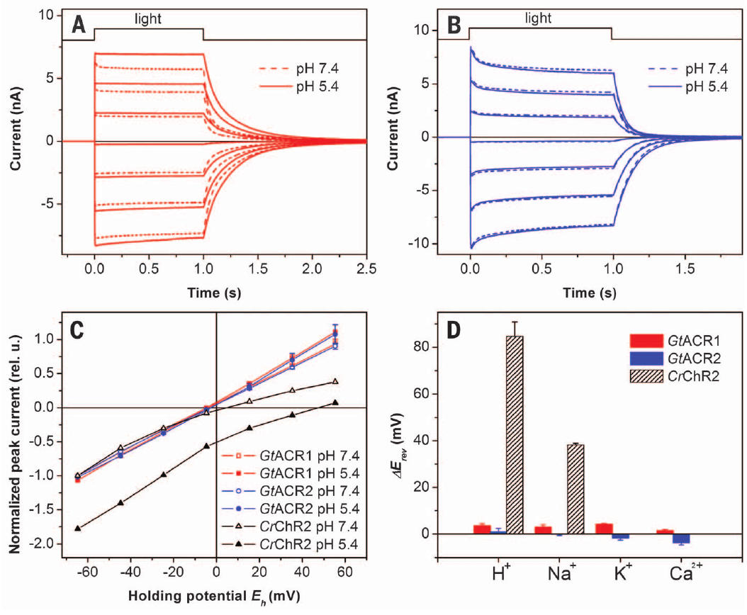
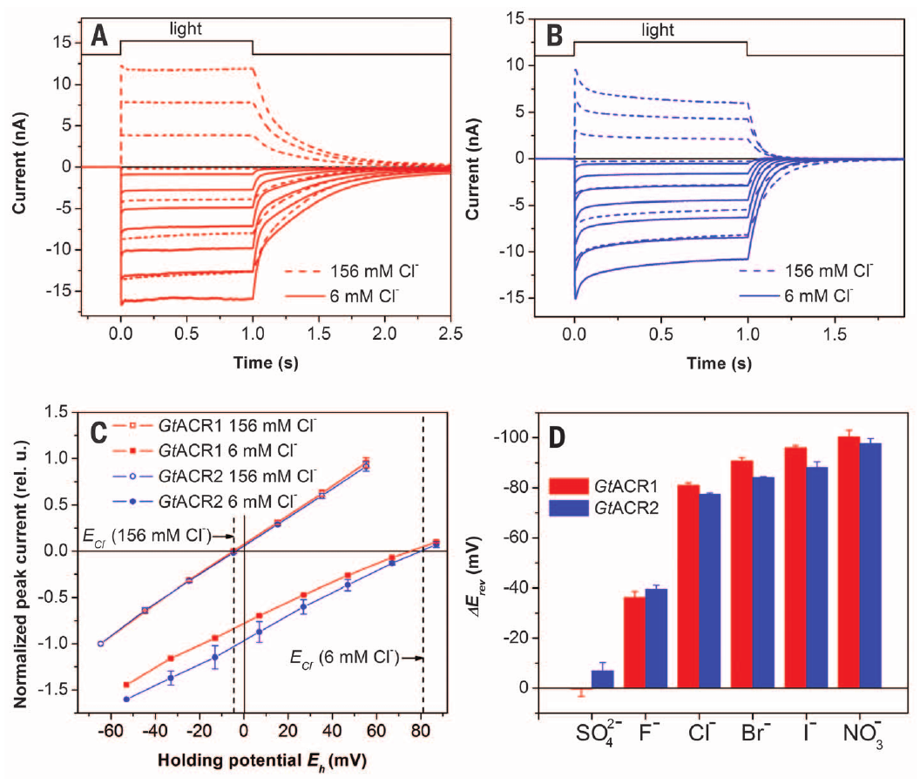
Anion channels conduct a different class of ions
Govorunova and colleagues put light-sensitive proteins from the cryptophyte alga Guillardia theta into mammalian cells. The two proteins, GtACR1 and GtACR2, act as anion channelrhodopsins, light-gated channels that carry negatively charged ions instead of the positive ions carried by ChR2.
Changing external sodium, potassium or calcium left the photocurrent reversal in place. Replacing chloride with a nonpermeant anion shifted the reversal, which identified chloride as the carried ion. Membrane voltage was stepped in 20 mV increments while the ion substitutions supplied the selectivity controls.
GtACRs produced an inward current in a high-chloride recording solution. The voltage effect of that current depends on the neuron's chloride gradient and its starting membrane voltage. The same channel can therefore excite one neuron and suppress another.
Govorunova et al. (2015), Fig. 2(A–D). Cation substitution and photocurrent reversal in GtACRs.
Govorunova et al. (2015), Fig. 3(A–D). Chloride substitution identifies anion selectivity.
Govorunova et al. (2015)
08
Notes:
• Govorunova and colleagues expressed light-sensitive proteins from the cryptophyte alga Guillardia theta in mammalian cells. Two proteins, GtACR1 and GtACR2, functioned as anion channelrhodopsins, light-gated channels carrying negatively charged ions rather than the positive ions carried by ChR2.
• Changing external sodium, potassium or calcium did not shift photocurrent reversal as expected for cation conduction. Replacing chloride with a nonpermeant anion did shift reversal. Currents were measured while membrane voltage varied in 20-mV steps, with ion substitutions providing the selectivity controls.
– The patch electrode solution determines much of the intracellular ion composition during a whole-cell recording. A current’s sign is therefore interpreted together with the actual solutions. The ion-substitution measurements distinguish what the channel conducts from whether a particular neuron is inhibited by that conductance.
• The chloride dependence supports anion conduction and excludes a simple inference from the sign of one recorded current. GtACRs could produce an inward current with a high-chloride recording solution. Whether the resulting voltage response excites or suppresses a neuron depends on its chloride gradient and starting membrane voltage.
References:
Elena G. Govorunova; Oleg A. Sineshchekov; Roger Janz; Xiaoqin Liu; John L. Spudich (2015). Natural light-gated anion channels: A family of microbial rhodopsins for advanced optogenetics. Science 349(6248): 647-650. https://doi.org/10.1126/science.aaa7484
Figure: Govorunova et al. (2015), Fig. 2(A–D). Cation substitution and photocurrent reversal in GtACRs.
Figure source: https://doi.org/10.1126/science.aaa7484
Figure: Govorunova et al. (2015), Fig. 3(A–D). Chloride substitution identifies anion selectivity.
Figure source: https://doi.org/10.1126/science.aaa7484

Slide 11
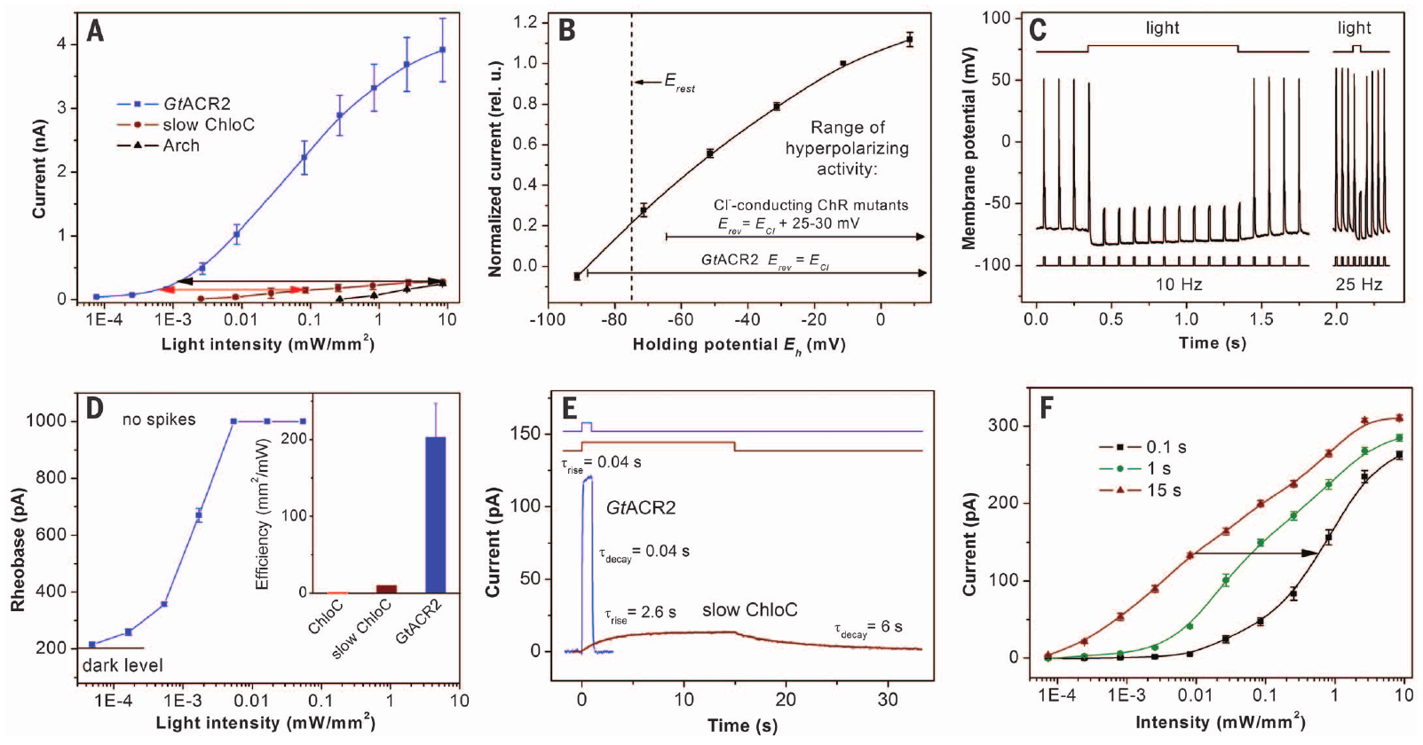
Optical silencing depends on the chloride gradient
A chloride equilibrium potential is the voltage at which the electrical and concentration forces acting on chloride balance. When an anion channel opens, the membrane voltage moves toward this value, so the effect depends on the ionic conditions of the cell rather than being fixed.
In cultured rat neurons, GtACR2 photocurrent reversed near −88 mV. Illumination suppressed current-evoked spikes in trains up to at least 25 Hz. In a ramp protocol, full suppression occurred at a light intensity of 0.005 mW/mm². The ramp tested a graded range of light intensities.
Expressing neurons kept their dark-state electrical properties and morphology, so the expression left the cells intact. Silencing was validated under the measured recording conditions, and each new cell type or species needs its own check of the chloride gradient before inhibition is assumed.
Govorunova et al. (2015), Fig. 4(A–F). GtACR2 current reversal, spike suppression and light sensitivity.
Boyden et al. (2005), Fig. 1(a). ChR2-YFP membrane expression in a cultured hippocampal neuron.
Govorunova et al. (2015); Boyden et al. (2005)
09
Notes:
• A chloride equilibrium potential is the voltage at which the electrical and concentration forces on chloride balance. Opening an anion channel moves the membrane response toward this voltage; it does not impose a universal hyperpolarizing effect independent of the cell’s ionic conditions.
• In cultured rat neurons studied by Govorunova and colleagues, GtACR2 photocurrent reversed near −88 mV. Illumination suppressed current-evoked spikes, including trains up to at least 25 Hz. In the tested ramp protocol, full suppression occurred at a light intensity of 0.005 mW/mm².
– The externally injected current attempts to make the neuron fire while the optical intervention changes its membrane conductance. Suppression during that challenge is stronger evidence of functional inhibition than fluorescence expression alone. The accompanying neuronal morphology comes from the foundational ChR2 study and is not an image of a GtACR2-expressing cell.
• Dark-state electrical properties and morphology were retained in expressing neurons. The experiment validates effective silencing under the measured recording conditions. It does not establish the same chloride gradient in every cell compartment or species, and therefore cannot replace direct validation of inhibition in a new behavioral preparation.
References:
Elena G. Govorunova; Oleg A. Sineshchekov; Roger Janz; Xiaoqin Liu; John L. Spudich (2015). Natural light-gated anion channels: A family of microbial rhodopsins for advanced optogenetics. Science 349(6248): 647-650. https://doi.org/10.1126/science.aaa7484
Edward S Boyden; Feng Zhang; Ernst Bamberg; Georg Nagel; Karl Deisseroth (2005). Millisecond-timescale, genetically targeted optical control of neural activity. Nature Neuroscience 8(9): 1263-1268. https://doi.org/10.1038/nn1525
Figure: Govorunova et al. (2015), Fig. 4(A–F). GtACR2 current reversal, spike suppression and light sensitivity.
Figure source: https://doi.org/10.1126/science.aaa7484
Figure: Boyden et al. (2005), Fig. 1(a). ChR2-YFP membrane expression in a cultured hippocampal neuron.
Figure source: https://doi.org/10.1038/nn1525

Slide 12
Chloride gradients set the silencing effect
Govorunova and colleagues used GtACR2 in cultured rat neurons to test whether light can silence cells. The photocurrent reversed near −88 mV, a voltage that depends on the chloride gradient across the membrane. The reversal voltage is the point where the measured current changes sign.
Illumination suppressed current-evoked spikes in trains up to at least 25 Hz. In a ramp protocol, full suppression occurred at a light intensity of 0.005 mW/mm², and the ramp tested a graded range of light intensities. Expressing neurons kept their dark-state electrical properties and morphology.
Opening an anion channel moves the membrane toward the chloride equilibrium potential, so the same light can hyperpolarize one cell and depolarize another. The starting voltage and the chloride gradient of each cell determine which outcome occurs. Silencing was validated under the measured recording conditions, so each new cell type needs its own chloride measurement.
Govorunova et al. (2015), Fig. 4(A–F). GtACR2 current reversal, spike suppression and light sensitivity.
Boyden et al. (2005), Fig. 1(a). ChR2-YFP membrane expression in a cultured hippocampal neuron.
Govorunova et al. (2015)
09a
Notes:
• Chloride gradients set the silencing effect.
• Explanation 1.
– Govorunova and colleagues used GtACR2 in cultured rat neurons to test whether light can silence cells
– The photocurrent reversed near −88 mV, a voltage that depends on the chloride gradient across the membrane. The reversal voltage is the point where the measured current changes sign.
• Explanation 2.
– Illumination suppressed current-evoked spikes in trains up to at least 25 Hz
– In a ramp protocol, full suppression occurred at a light intensity of 0.005 mW/mm², and the ramp tested a graded range of light intensities. Expressing neurons kept their dark-state electrical properties and morphology.
• Explanation 3.
– Opening an anion channel moves the membrane toward the chloride equilibrium potential, so the same light can hyperpolarize one cell and depolarize another
– The starting voltage and the chloride gradient of each cell determine which outcome occurs. Silencing was validated under the measured recording conditions, so each new cell type needs its own chloride measurement.
• Reversal.
– The photocurrent reversed near −88 mV in cultured rat neurons.
– That voltage depends on the chloride gradient.
• Suppression.
– Illumination suppressed spikes in trains up to at least 25 Hz.
– A ramp protocol reached full suppression at 0.005 mW/mm².
• Mechanism.
– An anion channel moves the membrane toward the chloride equilibrium potential.
– The same light can hyperpolarize one cell and depolarize another.
• Context.
– Dark-state properties of the expressing neurons were retained.
– The silencing was validated under the measured recording conditions.
References:
Elena G. Govorunova; Oleg A. Sineshchekov; Roger Janz; Xiaoqin Liu; John L. Spudich (2015). Natural light-gated anion channels: A family of microbial rhodopsins for advanced optogenetics. Science 349(6248): 647-650. https://doi.org/10.1126/science.aaa7484

Slide 13
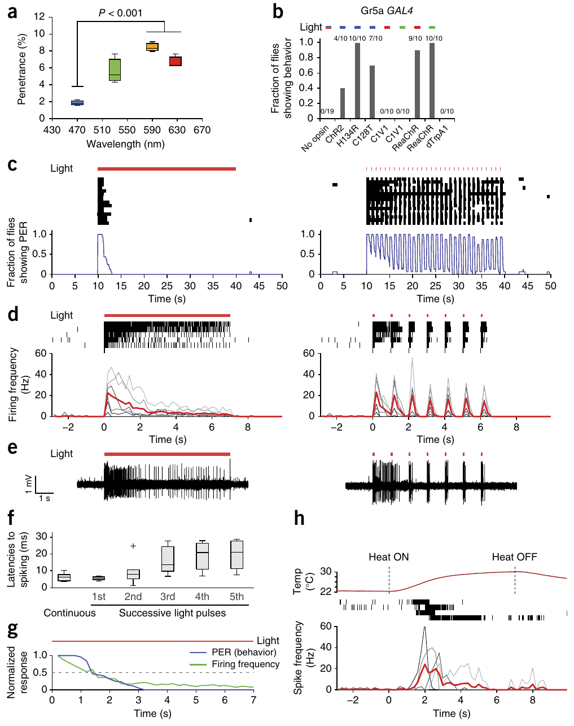
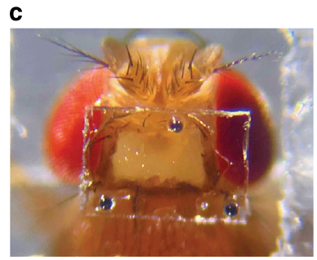
Red-shifted activation reaches neurons in intact flies
The adult fly's cuticle, its external covering, reduces the light that reaches internal neurons. Inagaki and colleagues measured light transmission and compared several opsins, the retinal-binding light-sensitive proteins, in peripheral and central neurons of intact Drosophila melanogaster.
The red-shifted channelrhodopsin ReaChR responded to 627 nm light. In gustatory receptor neurons, which detect chemical taste cues, 100 ms pulses at 1 Hz produced timed spiking and proboscis extension, the outward movement of the feeding appendage.
ReaChR also drove responses from central neurons under conditions where several blue-sensitive variants had no effect. Cuticle penetration, protein expression and membrane trafficking all contributed to how well the light worked. Red illumination also reduced a concern about visual stimulation.
Grover et al. (2020), Fig. 1(c). Head imaging window and retroreflective beads on an adult fly.
Inagaki et al. (2014), Fig. 1(a–h). Opsin comparisons, cuticle transmission and gustatory-neuron responses.
Inagaki et al. (2014); Grover et al. (2020)
10
Notes:
• The adult fly’s cuticle, its external body covering, limits light reaching internal neurons. Inagaki and colleagues measured light transmission and compared several opsins, retinal-binding light-sensitive proteins, in peripheral and central neuronal populations of intact Drosophila melanogaster.
• The red-activatable channelrhodopsin ReaChR supported stimulation with 627-nm light. In gustatory receptor neurons, cells that detect chemical taste cues, 100-ms pulses at 1 Hz produced temporally controlled spiking and proboscis extension, the outward movement of the feeding appendage.
– Trafficking is the movement of an expressed protein to the cellular location where it can act, including the membrane of neuronal processes. A wavelength that activates an isolated neuron well may work poorly through intact tissue. The adult-fly photograph is from the separate Flyception2 imaging preparation, not the ReaChR activation assay.
• ReaChR also drove central-neuron behavioral responses under conditions where several blue-sensitive variants were ineffective. Cuticle penetration, protein expression and membrane trafficking all contributed to efficacy. Red illumination reduced a visual-stimulation concern, but wavelength choice did not remove the need for light-only controls or physiological validation.
References:
Hidehiko K Inagaki; Yonil Jung; Eric D Hoopfer; Allan M Wong; Neeli Mishra; John Y Lin; Roger Y Tsien; David J Anderson (2014). Optogenetic control of Drosophila using a red-shifted channelrhodopsin reveals experience-dependent influences on courtship. Nature Methods 11(3): 325-332. https://doi.org/10.1038/nmeth.2765
Dhruv Grover; Takeo Katsuki; Jinfang Li; Thomas J. Dawkins; Ralph J. Greenspan (2020). Imaging brain activity during complex social behaviors in Drosophila with Flyception2. Nature Communications 11(1): 623. https://doi.org/10.1038/s41467-020-14487-7
Figure: Inagaki et al. (2014), Fig. 1(a–h). Opsin comparisons, cuticle transmission and gustatory-neuron responses.
Figure source: https://doi.org/10.1038/nmeth.2765
Figure: Grover et al. (2020), Fig. 1(c). Head imaging window and retroreflective beads on an adult fly.
Figure source: https://doi.org/10.1038/s41467-020-14487-7

Slide 14
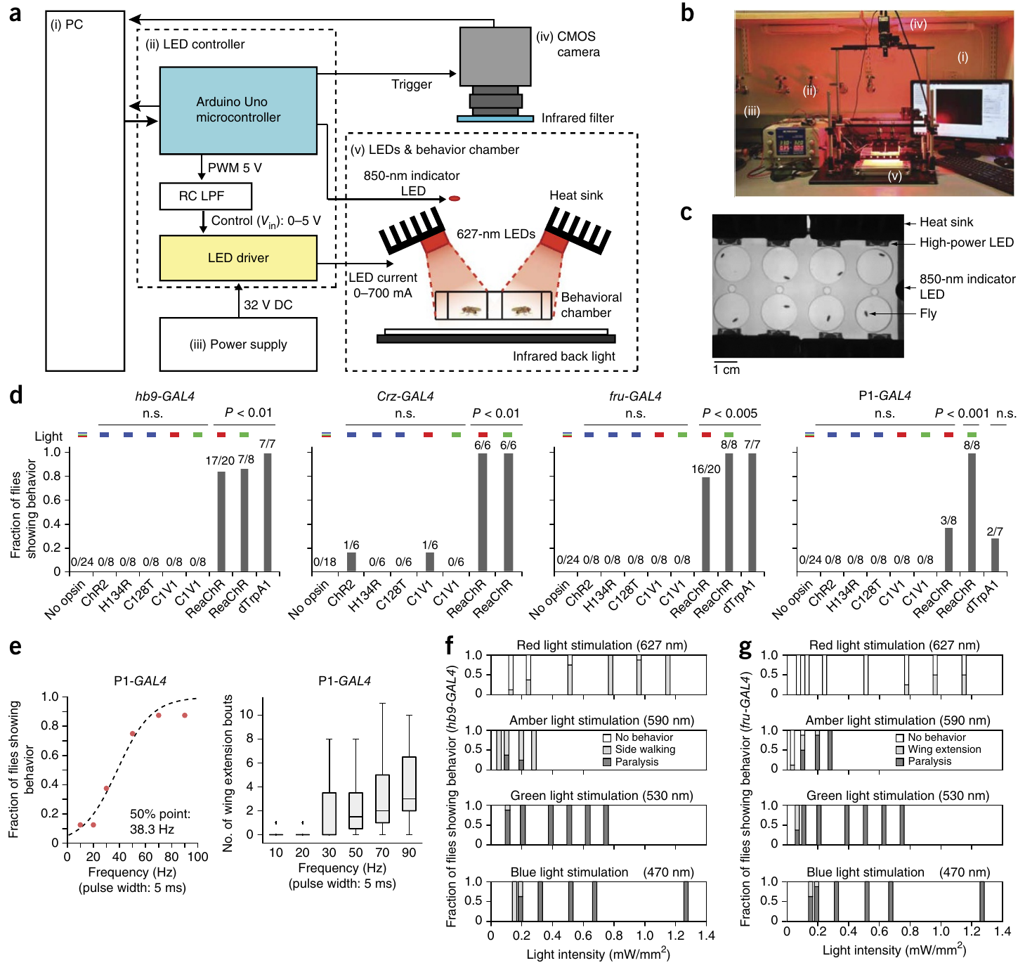
Matched light controls separate activation from sensation
Light can change behavior through the animal's normal sensory pathways as well as through an introduced opsin. Intact flies carrying different opsins were set against no-opsin controls by Inagaki and colleagues, with identical light and scoring conditions.
ReaChR activation evoked responses that depended on the targeted population, including wing extension and side walking, and no-opsin controls showed none of these responses. With 5 ms red-light pulses aimed at courtship-related P1 neurons, response probability rose with pulse frequency and reached a fitted midpoint near 38.3 Hz.
A dose-response relationship links stimulation strength to response probability, so the curve describes how an induced action scales with input. At high intensities some populations produced paralysis in place of the lower-intensity behavior, so control genotypes and intensity jointly set which neuronal contribution can be inferred.
Inagaki et al. (2014), Fig. 2(a–g). Intact-fly optical activation and matched no-opsin comparisons.
Inagaki et al. (2014)
11
Notes:
• Light can affect behavior through the animal’s normal sensory pathways as well as through an introduced opsin. Inagaki and colleagues compared intact flies expressing different opsins with no-opsin controls under the same illumination and behavioral scoring conditions.
• ReaChR activation recruited distinct responses depending on the targeted population, including wing extension and side walking. No-opsin controls did not produce these characteristic responses. With 5-ms red-light pulses targeting courtship-related P1 brain neurons, response probability increased with pulse frequency, reaching its fitted midpoint near 38.3 Hz.
– A control animal sees the light and experiences the chamber without carrying the functional actuator in the tested cells. That comparison tests ordinary sensory responses to illumination. Increasing activation can recruit a different motor outcome, so the existence of a dose-dependent effect is not proof that every dose reproduces natural circuit operation.
• A dose-response relationship links stimulation strength to response probability, but cannot alone identify a natural neuronal firing rate. At high activation intensities some populations produced paralysis rather than the lower-intensity behavior. Control genotypes and stimulation intensity therefore constrain which neuronal contribution can be inferred from an induced action.
References:
Hidehiko K Inagaki; Yonil Jung; Eric D Hoopfer; Allan M Wong; Neeli Mishra; John Y Lin; Roger Y Tsien; David J Anderson (2014). Optogenetic control of Drosophila using a red-shifted channelrhodopsin reveals experience-dependent influences on courtship. Nature Methods 11(3): 325-332. https://doi.org/10.1038/nmeth.2765
Figure: Inagaki et al. (2014), Fig. 2(a–g). Intact-fly optical activation and matched no-opsin comparisons.
Figure source: https://doi.org/10.1038/nmeth.2765

Slide 15
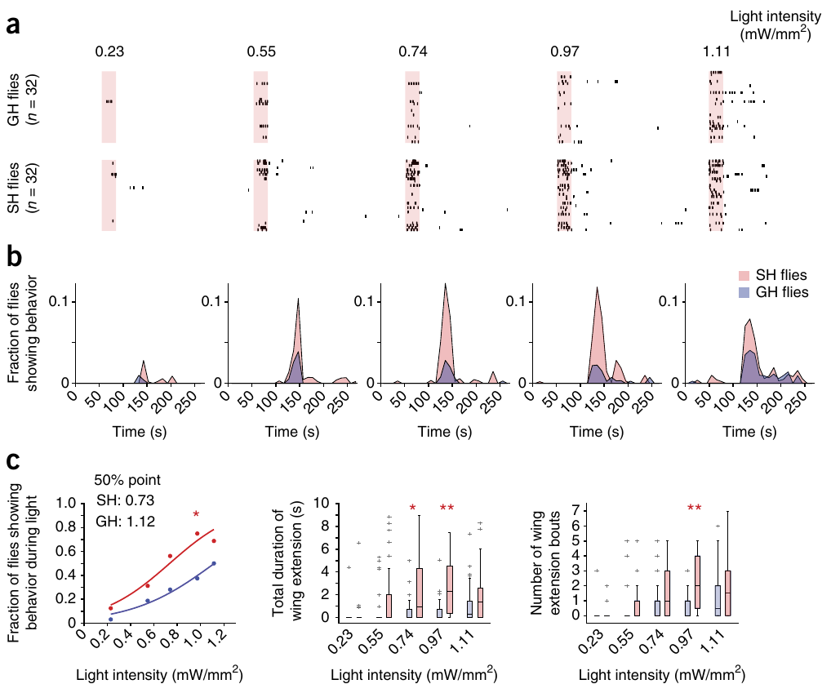
Social history changes the effect of P1 activation
Courtship control involves P1 neurons, a male-specific set of brain interneurons. An interneuron links processing stages rather than serving directly as a muscle's motor output. After 7 days of single or group housing, Inagaki and colleagues measured how readily ReaChR activation produced wing extension. Wing extension served as the measured readout of that circuit.
Males housed alone reacted to weaker red light than males housed in groups. Activating the descending courtship neurons pIP10 instead produced no housing-dependent shift in sensitivity. Both experiments used matched stimulation methods while the social experience of the animals changed.
Experience therefore changes how strongly activation at P1, or at a downstream stage before the pIP10 output, drives wing extension. Social history thus modifies the behavioral consequence of activation while the light stimulus stays the same.
Inagaki et al. (2014), Fig. 3(b). Published P1 and pIP10 circuit arrangement; connectivity is proposed.
Inagaki et al. (2014), Fig. 4(a–c). Social housing changes P1-evoked wing-extension sensitivity.
Inagaki et al. (2014)
12
Notes:
• P1 neurons are a male-specific group of brain interneurons implicated in courtship control. An interneuron connects neural processing stages rather than directly serving as a muscle’s motor output. Inagaki and colleagues compared ReaChR-driven wing extension after 7 days of single or group housing.
• Single-housed males responded at lower red-light intensities than group-housed males. By contrast, activating the descending courtship neurons pIP10 did not reveal the same housing-dependent sensitivity shift. The comparison used matched stimulation methods while changing the animal’s social experience.
– Wing extension is the measured courtship-associated movement, rather than a claim about a subjective motivational state. The different housing effects at two activation sites constrain where the experience-dependent change could act. They do not prove that all neurons downstream of P1 changed or that pIP10 is the only pathway used by natural courtship.
• Experience therefore modifies the behavioral consequence of activation at P1 or a functionally downstream stage preceding the pIP10-dependent output. The result does not establish a specific transmitter, receptor or intracellular plasticity mechanism. The published circuit arrangement marks proposed functional relationships rather than a complete synaptically verified connection map.
References:
Hidehiko K Inagaki; Yonil Jung; Eric D Hoopfer; Allan M Wong; Neeli Mishra; John Y Lin; Roger Y Tsien; David J Anderson (2014). Optogenetic control of Drosophila using a red-shifted channelrhodopsin reveals experience-dependent influences on courtship. Nature Methods 11(3): 325-332. https://doi.org/10.1038/nmeth.2765
Figure: Inagaki et al. (2014), Fig. 4(a–c). Social housing changes P1-evoked wing-extension sensitivity.
Figure source: https://doi.org/10.1038/nmeth.2765
Figure: Inagaki et al. (2014), Fig. 3(b). Published P1 and pIP10 circuit arrangement; connectivity is proposed.
Figure source: https://doi.org/10.1038/nmeth.2765

Slide 16
Housing changes wing-extension sensitivity
Inagaki and colleagues housed males alone or in groups for 7 days before testing them with red light. Wing extension was the measured readout of the courtship circuit, and each male was stimulated across a range of light intensities with the same method.
Males housed alone responded to weaker red light than males housed in groups. Activating the descending courtship neurons pIP10 produced no comparable shift, even though the stimulation method matched across the two groups. Housing-dependent sensitivity therefore appeared for P1 activation but not for pIP10 activation.
The housing effect acts at P1 or at a downstream stage before pIP10, so social experience changes how strongly the same light input drives wing extension. The light stimulus stays constant while the behavioral response changes with housing history. Social history thus modifies the behavioral consequence of an identical input.
Inagaki et al. (2014), Fig. 3(b). Published P1 and pIP10 circuit arrangement; connectivity is proposed.
Inagaki et al. (2014), Fig. 4(a–c). Social housing changes P1-evoked wing-extension sensitivity.
Inagaki et al. (2014)
12a
Notes:
• Housing changes wing-extension sensitivity.
• Explanation 1.
– Inagaki and colleagues housed males alone or in groups for 7 days before testing them with red light
– Wing extension was the measured readout of the courtship circuit, and each male was stimulated across a range of light intensities with the same method.
• Explanation 2.
– Males housed alone responded to weaker red light than males housed in groups
– Activating the descending courtship neurons pIP10 produced no comparable shift, even though the stimulation method matched across the two groups. Housing-dependent sensitivity therefore appeared for P1 activation but not for pIP10 activation.
• Explanation 3.
– The housing effect acts at P1 or at a downstream stage before pIP10, so social experience changes how strongly the same light input drives wing extension
– The light stimulus stays constant while the behavioral response changes with housing history. Social history thus modifies the behavioral consequence of an identical input.
• Design.
– Males were housed alone or in groups for 7 days.
– Red-light intensities were then varied during testing.
• Result.
– Single-housed males responded at lower intensities.
– The pIP10 activation showed no comparable shift.
• Locus.
– The housing effect acts at P1 or upstream of pIP10.
– The light input stays the same across groups.
• Context.
– The stimulation method matched across the two groups.
– The social experience was the difference between them.
References:
Hidehiko K Inagaki; Yonil Jung; Eric D Hoopfer; Allan M Wong; Neeli Mishra; John Y Lin; Roger Y Tsien; David J Anderson (2014). Optogenetic control of Drosophila using a red-shifted channelrhodopsin reveals experience-dependent influences on courtship. Nature Methods 11(3): 325-332. https://doi.org/10.1038/nmeth.2765

Slide 17
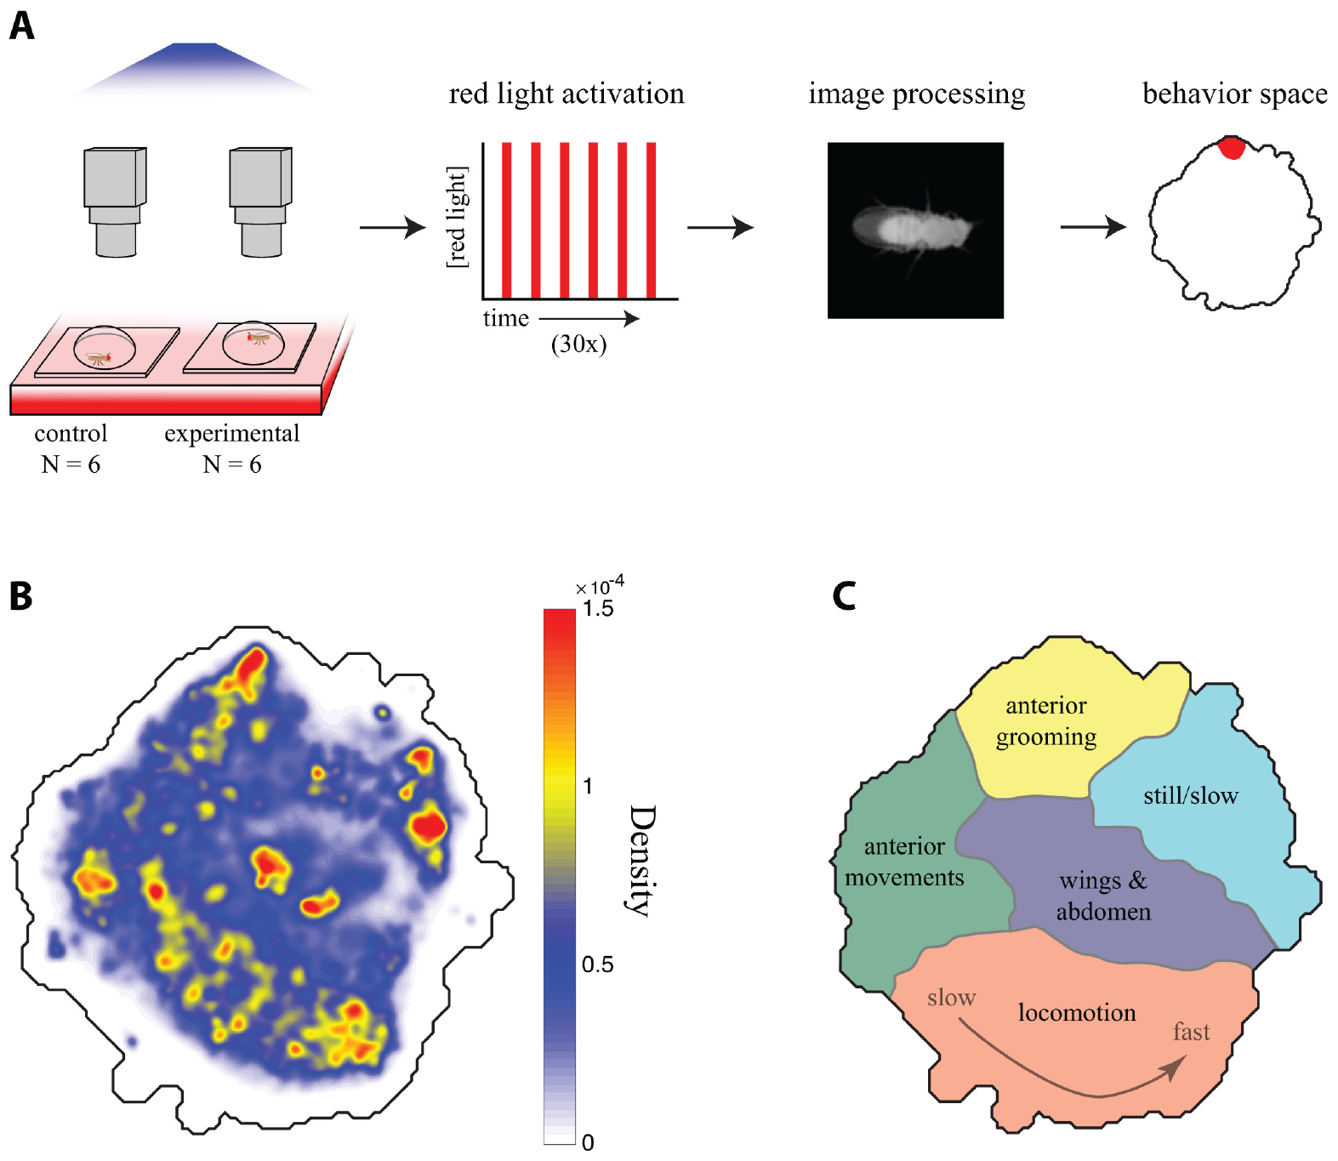
Intersectional targeting restricts descending-cell drive
The split-GAL4 system restricts expression by combining two separately expressed parts of a transcriptional activator, a protein that switches on gene expression. Gene activation occurs where the two expression patterns overlap strongly. The intersectional strategy was the one Cande and colleagues applied to reach sparse descending-neuron groups.
The actuator CsChrimson converted 617 nm illumination into a timed depolarizing stimulus. Experimental and control flies carried the same genetic construct, and experimental flies alone received supplemental retinal. Repeated 15 s activation epochs tested the behavioral effects of the targeted population.
A sparse expression pattern sharpens anatomical specificity. When several cells express the actuator, a behavioral phenotype can still arise from more than one cell, so the expression pattern of each screened line must be verified. Restricted access and physiological efficacy are separate requirements that each line has to meet.
Inagaki et al. (2014), Fig. 3(b). Published P1 and pIP10 circuit arrangement; connectivity is proposed.
Cande et al. (2018), Fig. 1(A–C). Retinal controls, optical stimulation and behavioral occupancy.
Cande et al. (2018); Inagaki et al. (2014)
13
Notes:
• The split-GAL4 system restricts expression by combining two separately expressed parts of a transcriptional activator, a protein that turns on gene expression. Only cells where these expression patterns overlap strongly activate the linked actuator gene. Cande and colleagues used this intersectional strategy to target sparse descending-neuron populations.
• The actuator CsChrimson converted 617-nm illumination into a timed depolarizing intervention. Experimental and control flies shared the genetic construct, but only experimental flies received supplemental retinal. Repeated 15-s activation epochs tested the behavioral consequences of the genetically targeted population.
– A transcriptional activator controls expression of the linked construct rather than directly producing a spike. The genetic intersection determines where the light-sensitive channel is present, while the light pulse determines when it is activated. Controls with the same genotype retain possible expression-related effects while altering whether the channel has its supplied light-absorbing cofactor.
• A sparse expression pattern increases anatomical specificity, but does not prove that a behavioral phenotype belongs to one cell if several cells express the actuator. Restricted access and physiological efficacy are separate requirements. The published courtship pathway supplies an identified descending example; it is not a replacement for verifying each screened line’s expression pattern.
References:
Jessica Cande; Shigehiro Namiki; Jirui Qiu; Wyatt Korff; Gwyneth M Card; Joshua W Shaevitz; David L Stern; Gordon J Berman (2018). Optogenetic dissection of descending behavioral control in Drosophila. eLife 7: e34275. https://doi.org/10.7554/elife.34275
Hidehiko K Inagaki; Yonil Jung; Eric D Hoopfer; Allan M Wong; Neeli Mishra; John Y Lin; Roger Y Tsien; David J Anderson (2014). Optogenetic control of Drosophila using a red-shifted channelrhodopsin reveals experience-dependent influences on courtship. Nature Methods 11(3): 325-332. https://doi.org/10.1038/nmeth.2765
Figure: Cande et al. (2018), Fig. 1(A–C). Retinal controls, optical stimulation and behavioral occupancy.
Figure source: https://doi.org/10.7554/elife.34275
Figure: Inagaki et al. (2014), Fig. 3(b). Published P1 and pIP10 circuit arrangement; connectivity is proposed.
Figure source: https://doi.org/10.1038/nmeth.2765

Slide 18
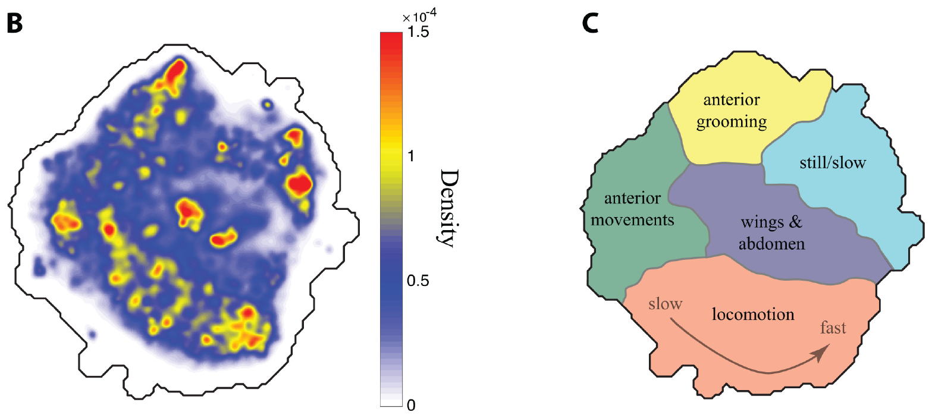
Posture dynamics resolve a broad behavioral repertoire
Behavior can shift while walking speed stays nearly constant. Cande and colleagues recorded freely moving flies at 100 frames per second, aligned their body images and represented postures over time in a low-dimensional behavior space, a map that groups similar movement patterns together.
Different regions of the map contained anterior grooming, wing and abdomen movements, slow postures and locomotion. Occupancy measured how often a fly performed the movements assigned to each region. Occupancy during red-light activation, set against matched controls, distinguished action-specific effects from a general rise in activity.
The map is an empirical description of movements sampled in this arena rather than a map of neural anatomy. Sampling at 100 frames per second sets the time scale of the movements the map captures, and the flat chamber sets which behaviors can appear. A quantitative classifier gives reproducible measurements within those bounds.
Cande et al. (2018), Fig. 1(B–C). Published behavioral-density map and action categories.
Cande et al. (2018)
14
Notes:
• A behavioral response can change without a large change in walking speed. Cande and colleagues recorded freely moving flies at 100 frames/s, aligned their body images and represented time-varying postures in a low-dimensional behavior space, a map grouping similar movement patterns.
• Different regions contained anterior grooming, wing and abdomen movements, slow postures and locomotion. Occupancy measured how often a fly performed the movements assigned to a region. Comparing occupancy during red-light activation with matched controls distinguished action-specific effects from a general activity increase.
– Posture alignment removes differences in overall position and orientation before movements are compared. Similar body dynamics can then be grouped even when the fly occupies different parts of the chamber. The resulting action categories describe what the video captured, rather than an exhaustive catalogue of everything a fly can do.
• The map is an empirical description of movements sampled in this arena, not a map of neural anatomy. Its temporal sampling cannot resolve arbitrarily fast actions, and the flat chamber limits the available behavioral repertoire. A quantitative classifier therefore supports reproducible measurement while retaining the constraints of the preparation.
References:
Jessica Cande; Shigehiro Namiki; Jirui Qiu; Wyatt Korff; Gwyneth M Card; Joshua W Shaevitz; David L Stern; Gordon J Berman (2018). Optogenetic dissection of descending behavioral control in Drosophila. eLife 7: e34275. https://doi.org/10.7554/elife.34275
Figure: Cande et al. (2018), Fig. 1(B–C). Published behavioral-density map and action categories.
Figure source: https://doi.org/10.7554/elife.34275

Slide 19
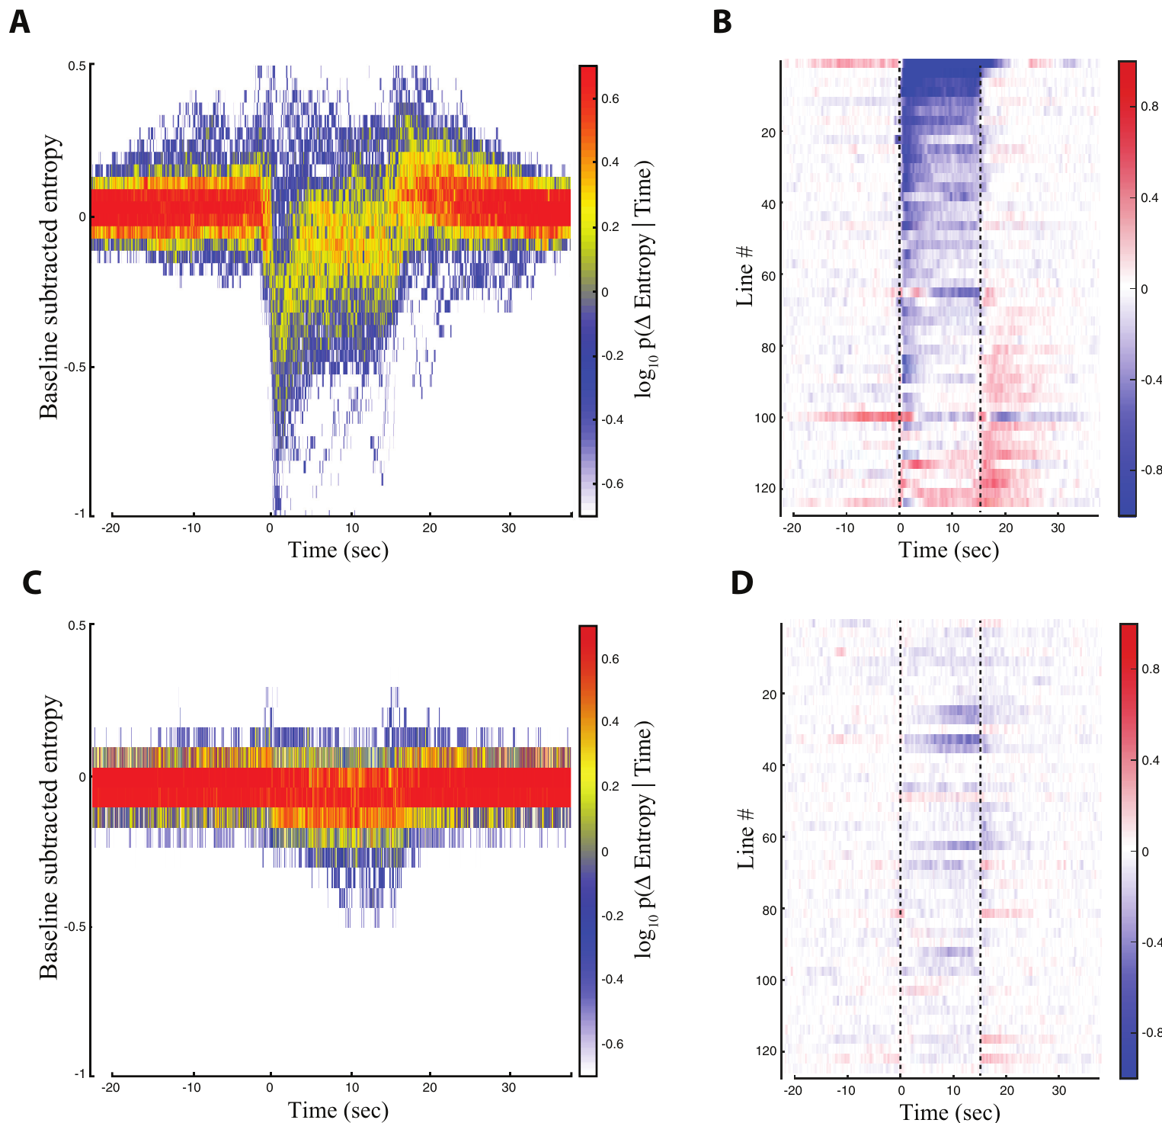
Descending activation often favors one motor module
A motor module is a coordinated part of behavior that can be recruited on its own, without triggering a complete behavioral sequence. Cande and colleagues asked whether activating descending neurons concentrated movement into particular regions of the behavior space they had measured.
During 15 s red-light epochs, many experimental flies showed reduced behavioral entropy, a measure of how broadly their activity spread across available actions. Matched controls without retinal showed no such population-level reduction. Most effective lines favored one behavioral region.
Modular recruitment, under these arena and stimulation conditions, means that a single descending population can bias behavior toward one class of actions. Selective tests of normal activity, necessity and context offer the way to determine how many distinct actions each targeted neuron commands.
Inagaki et al. (2014), Fig. 3(b). Published P1 and pIP10 circuit arrangement; connectivity is proposed.
Cande et al. (2018), Fig. 3(A–D). Behavioral entropy across descending-neuron lines.
Cande et al. (2018); Inagaki et al. (2014)
15
Notes:
• A motor module is a coordinated component of behavior that can be recruited without necessarily producing an entire behavioral sequence. Cande and colleagues asked whether descending-neuron activation concentrated movement into particular regions of their empirically measured behavior space.
• During 15-s red-light epochs, many experimental flies showed reduced behavioral entropy, a measure of how broadly their activity was distributed across available actions. Matched no-retinal controls did not display the same population-level reduction. Most effective lines predominantly favored one behavioral region.
– A lower entropy means that behavior becomes concentrated into fewer sampled patterns rather than that the animal necessarily moves less. One fly can walk vigorously while spending nearly all its time in a narrow locomotor pattern. Modular recruitment is therefore evaluated from the distribution of movement, not from speed alone.
• The results support modular control under these arena and stimulation conditions. They do not establish that each descending neuron has only one function, or that every targeted population is a dedicated command for one natural action. The alternative command interpretation requires more selective testing of normal activity, necessity and context.
References:
Jessica Cande; Shigehiro Namiki; Jirui Qiu; Wyatt Korff; Gwyneth M Card; Joshua W Shaevitz; David L Stern; Gordon J Berman (2018). Optogenetic dissection of descending behavioral control in Drosophila. eLife 7: e34275. https://doi.org/10.7554/elife.34275
Hidehiko K Inagaki; Yonil Jung; Eric D Hoopfer; Allan M Wong; Neeli Mishra; John Y Lin; Roger Y Tsien; David J Anderson (2014). Optogenetic control of Drosophila using a red-shifted channelrhodopsin reveals experience-dependent influences on courtship. Nature Methods 11(3): 325-332. https://doi.org/10.1038/nmeth.2765
Figure: Cande et al. (2018), Fig. 3(A–D). Behavioral entropy across descending-neuron lines.
Figure source: https://doi.org/10.7554/elife.34275
Figure: Inagaki et al. (2014), Fig. 3(b). Published P1 and pIP10 circuit arrangement; connectivity is proposed.
Figure source: https://doi.org/10.1038/nmeth.2765

Slide 20
Single neurons bias behavior toward one action
Cande and colleagues measured behavior in a low-dimensional map that groups similar movements, then asked whether activating a descending population moved behavior toward one region of that map. Occupancy counted how often each fly performed the movements assigned to a region.
Many experimental flies showed reduced behavioral entropy during 15 s red-light epochs, which means their activity spread across fewer actions. Matched controls without retinal showed no such population-level reduction. Most effective lines favored one behavioral region. Entropy is a measure of how broadly activity is distributed across the available actions.
The pattern points to modular control, in which a descending population recruits a coherent part of the movement repertoire. Selective tests of normal activity, necessity and context would show whether each neuron serves one command or several. Each tested line therefore recruits a defined region of the behavior space.
Inagaki et al. (2014), Fig. 3(b). Published P1 and pIP10 circuit arrangement; connectivity is proposed.
Cande et al. (2018), Fig. 3(A–D). Behavioral entropy across descending-neuron lines.
Cande et al. (2018)
15a
Notes:
• Single neurons bias behavior toward one action.
• Explanation 1.
– Cande and colleagues measured behavior in a low-dimensional map that groups similar movements, then asked whether activating a descending population moved behavior toward one region of that map
– Occupancy counted how often each fly performed the movements assigned to a region.
• Explanation 2.
– Many experimental flies showed reduced behavioral entropy during 15 s red-light epochs, which means their activity spread across fewer actions
– Matched controls without retinal showed no such population-level reduction. Most effective lines favored one behavioral region. Entropy is a measure of how broadly activity is distributed across the available actions.
• Explanation 3.
– The pattern points to modular control, in which a descending population recruits a coherent part of the movement repertoire
– Selective tests of normal activity, necessity and context would show whether each neuron serves one command or several. Each tested line therefore recruits a defined region of the behavior space.
• Map.
– Behavior was described in a low-dimensional map of similar movements.
– Occupancy was tracked for each red-light activation.
• Entropy.
– Many experimental flies showed reduced behavioral entropy.
– Matched controls showed no such reduction.
• Modularity.
– Most effective lines favored one behavioral region.
– A descending population can recruit a coherent part of the repertoire.
• Context.
– The effect was measured in an arena with stimulation at 15 s epochs.
– Entropy measures how broadly activity spreads across actions.
References:
Jessica Cande; Shigehiro Namiki; Jirui Qiu; Wyatt Korff; Gwyneth M Card; Joshua W Shaevitz; David L Stern; Gordon J Berman (2018). Optogenetic dissection of descending behavioral control in Drosophila. eLife 7: e34275. https://doi.org/10.7554/elife.34275

Slide 21
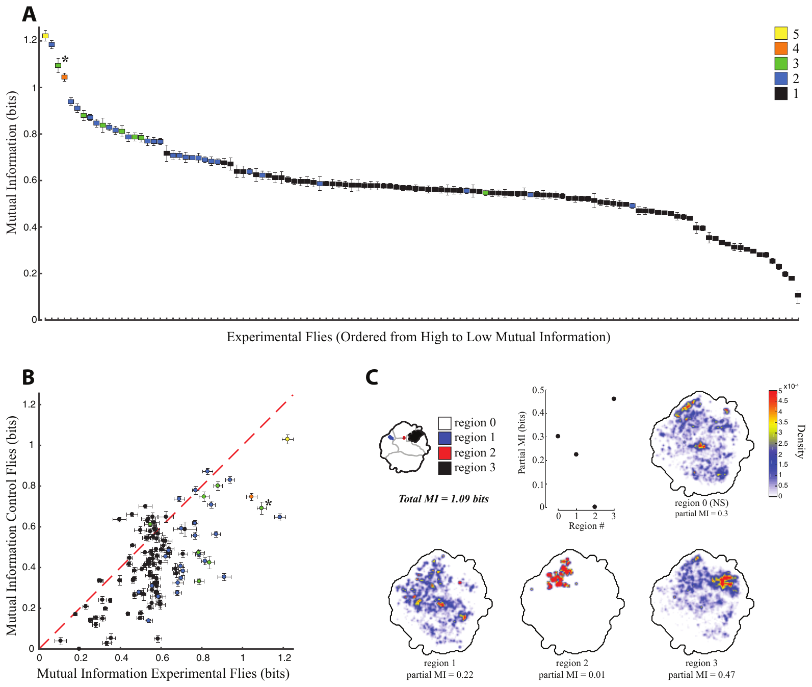
The preceding action constrains the activated response
Light-driven activation engages a circuit that is already active during behavior. Cande and colleagues related each fly's movement in the 1.5 s before stimulation to its movement during the first 1.5 s of red-light activation. Its output therefore depends on what the animal is already doing.
For some descending-neuron lines, the action after activation depended strongly on the action that came before it. Mutual information measures how much knowing the earlier behavioral state predicts the later one, and for many lines this dependence exceeded that in matched no-retinal controls.
The result supports state-dependent recruitment, in which the same activation produces different actions depending on the current behavior. Sensory input, the activity of other neurons and the state of local motor networks can each contribute to this context effect.
Inagaki et al. (2014), Fig. 3(b). Published P1 and pIP10 circuit arrangement; connectivity is proposed.
Cande et al. (2018), Fig. 5(A–C). Dependence of stimulated behavior on preceding behavior.
Cande et al. (2018); Inagaki et al. (2014)
16
Notes:
• Optical activation acts on a circuit that is already participating in behavior. Cande and colleagues related a fly’s movement in the 1.5 s before stimulation to its movement during the first 1.5 s of red-light activation.
• For some descending-neuron lines, the action after activation depended strongly on the action before it. Mutual information quantified how much knowing the earlier behavioral state predicted the later state. The relationship exceeded the corresponding dependence in matched no-retinal controls for many lines.
– The stimulation is identical across trials, but the network is not necessarily in the same condition when it begins. A dependency on the preceding action can occur within a single individual. It therefore need not be attributed solely to genetic differences between flies or to a change in the channel itself.
• The effect supports state-dependent recruitment rather than an invariant mapping from cell activation to action. The measurement identifies a behavioral dependency, not the synaptic mechanism that implements it. Sensory input, the activity of other neurons and the state of local motor networks remain possible contributors to the same context effect.
References:
Jessica Cande; Shigehiro Namiki; Jirui Qiu; Wyatt Korff; Gwyneth M Card; Joshua W Shaevitz; David L Stern; Gordon J Berman (2018). Optogenetic dissection of descending behavioral control in Drosophila. eLife 7: e34275. https://doi.org/10.7554/elife.34275
Hidehiko K Inagaki; Yonil Jung; Eric D Hoopfer; Allan M Wong; Neeli Mishra; John Y Lin; Roger Y Tsien; David J Anderson (2014). Optogenetic control of Drosophila using a red-shifted channelrhodopsin reveals experience-dependent influences on courtship. Nature Methods 11(3): 325-332. https://doi.org/10.1038/nmeth.2765
Figure: Cande et al. (2018), Fig. 5(A–C). Dependence of stimulated behavior on preceding behavior.
Figure source: https://doi.org/10.7554/elife.34275
Figure: Inagaki et al. (2014), Fig. 3(b). Published P1 and pIP10 circuit arrangement; connectivity is proposed.
Figure source: https://doi.org/10.1038/nmeth.2765

Slide 22
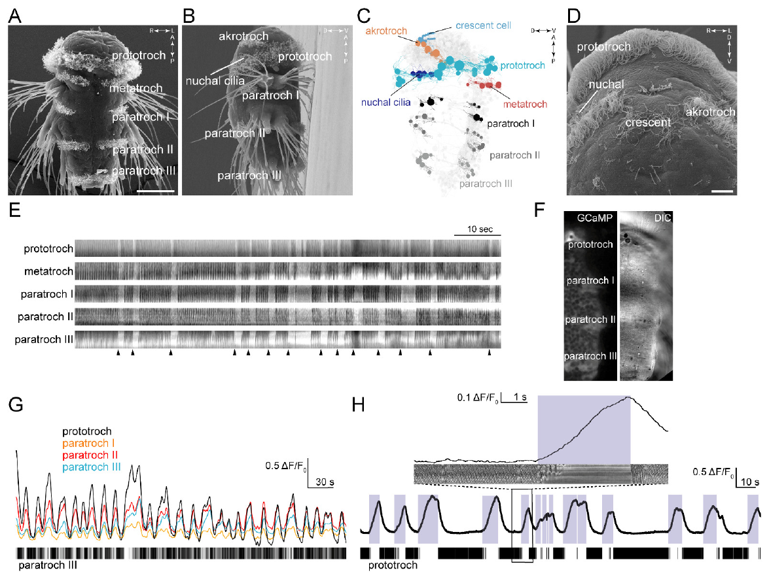
Ciliary arrests coordinate an entire larval body
Cilia, which are microscopic moving projections on specialized cells, propel the marine annelid Platynereis dumerilii. At about 72 h after fertilization, locomotor cilia form a main band called the prototroch, along with additional bands distributed along the larval trunk.
Verasztó and colleagues brought together scanning electron microscopy, fast video and calcium imaging. The different locomotor bands stopped beating together and resumed together, and each arrest coincided with a coordinated rise in calcium-indicator fluorescence across the ciliated fields.
A calcium indicator changes fluorescence as intracellular calcium rises and falls, giving an indirect readout of cell activation. The synchrony links a distributed set of effectors to one shared event, and identifying the neurons that trigger that event takes separate experiments.
Verasztó et al. (2017), Fig. 1(A–H). Larval ciliary bands, arrests and calcium activity.
Verasztó et al. (2017)
17
Notes:
• The marine annelid Platynereis dumerilii swims using cilia, microscopic moving projections on specialized cells. At approximately 72 h after fertilization, locomotor cilia form a main band called the prototroch and additional bands distributed along the larval trunk.
• Verasztó and colleagues combined scanning electron microscopy, high-speed observation and calcium imaging. The different locomotor bands repeatedly stopped beating together and resumed together. Arrests coincided with coordinated increases in calcium-indicator fluorescence across the ciliated fields.
– A kymograph condenses movement along a selected spatial line over time. In this preparation it relates ciliary motion to calcium changes in the same ciliary bands. The anatomical measurements identify where the beating cells lie, while the synchronized recordings establish that their arrests are coordinated across the body.
• A calcium indicator changes fluorescence as intracellular calcium changes, providing an indirect measure of cellular activation. Synchrony connects a distributed effector system to a common functional event. It does not alone identify the neurons causing that event, and the imaging preparation must be distinguished from the freely swimming animal’s complete behavior.
References:
Csaba Verasztó; Nobuo Ueda; Luis A Bezares-Calderón; Aurora Panzera; Elizabeth A Williams; Réza Shahidi; Gáspár Jékely (2017). Ciliomotor circuitry underlying whole-body coordination of ciliary activity in the Platynereis larva. eLife 6: e26000. https://doi.org/10.7554/elife.26000
Figure: Verasztó et al. (2017), Fig. 1(A–H). Larval ciliary bands, arrests and calcium activity.
Figure source: https://doi.org/10.7554/elife.26000

Slide 23
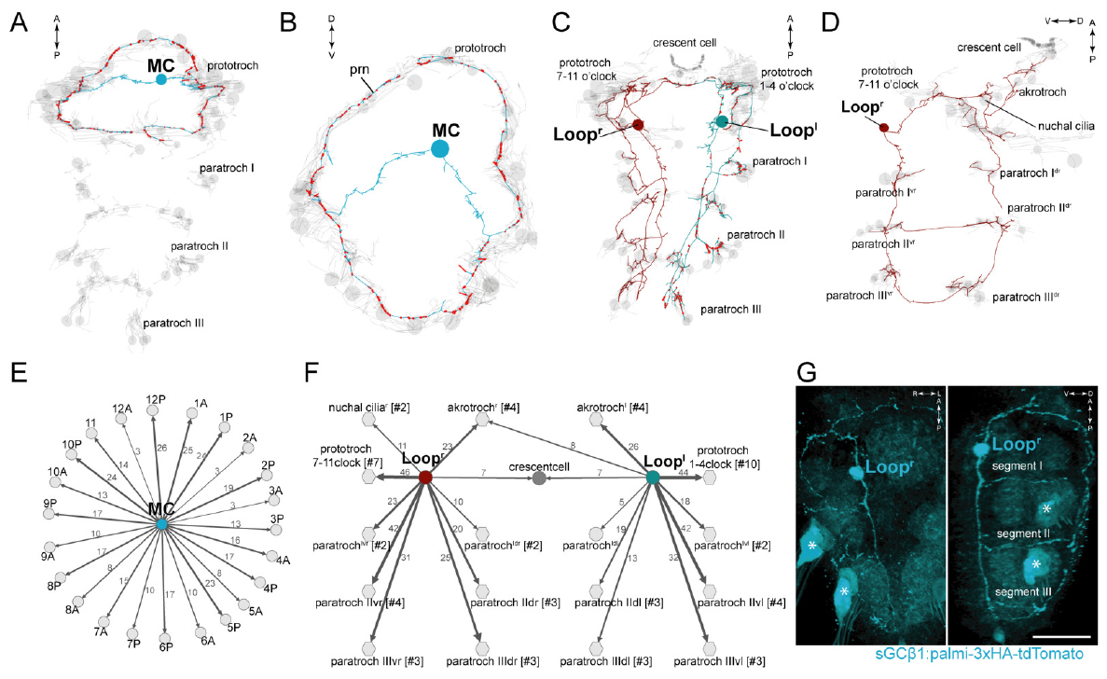
Serial reconstruction locates ciliomotor connections
A connectome maps the identified neural connections inside a reconstructed nervous system. Using serial transmission electron microscopy on a 3-day-old Platynereis larva, Verasztó and colleagues followed neurons and their synaptic contacts, matching them to where ciliated cells sit across the body.
The large MC neuron and the paired Loop neurons formed extensive contacts with the locomotor ciliary bands. Molecular labeling and cell morphology supported a cholinergic identity, meaning that these cells use acetylcholine as their transmitter. Axons reached several positions along the body.
According to this reconstruction, a small set of neurons can coordinate effectors that lie far apart. A synaptic contact by itself sets neither the timing nor the sign of the functional response, so calcium recordings and selective interventions are needed to show which reconstructed neurons take part in arrests.
Verasztó et al. (2017), Fig. 2(A–G). Reconstructed cholinergic neurons and ciliary targets.
Verasztó et al. (2017)
18
Notes:
• A connectome records identified neural connections within a reconstructed nervous system. Verasztó and colleagues traced neurons and their synaptic contacts through serial transmission electron microscopy of a 3-day-old Platynereis larva, relating them to the whole-body distribution of ciliated cells.
• The large MC neuron and paired Loop neurons formed extensive contacts with locomotor ciliary bands. Cholinergic neurons use acetylcholine as a transmitter; their identity was supported by molecular labeling and cell morphology. Axons, neuronal processes that carry signals toward targets, reached several positions along the body.
– Serial electron microscopy follows the same cellular processes through successive ultrathin sections. A contact can be assigned to an identified presynaptic neuron and a postsynaptic target. The wiring supplies a physical route for coordination, but it does not measure what that route is doing during a particular swimming episode.
• The reconstruction constrains how a small set of neurons can coordinate widely separated effectors. A structural synapse does not specify the timing or sign of every functional response. Calcium recordings and selective interventions were therefore needed to determine whether these reconstructed neurons actually participated in ciliary arrests.
References:
Csaba Verasztó; Nobuo Ueda; Luis A Bezares-Calderón; Aurora Panzera; Elizabeth A Williams; Réza Shahidi; Gáspár Jékely (2017). Ciliomotor circuitry underlying whole-body coordination of ciliary activity in the Platynereis larva. eLife 6: e26000. https://doi.org/10.7554/elife.26000
Figure: Verasztó et al. (2017), Fig. 2(A–G). Reconstructed cholinergic neurons and ciliary targets.
Figure source: https://doi.org/10.7554/elife.26000

Slide 24
Serial reconstruction maps ciliomotor wiring
Serial transmission electron microscopy of a 3-day-old Platynereis larva allowed Verasztó and colleagues to trace neurons and their synaptic contacts. The reconstruction was related to the whole-body distribution of ciliated cells. The map therefore links specific neurons to specific sites of ciliary control.
The large MC neuron and the paired Loop neurons made extensive contacts with the locomotor ciliary bands. Molecular labeling and cell morphology supported a cholinergic identity, meaning that these cells use acetylcholine as their transmitter. Axons reached several positions along the body.
A structural synapse sets neither the timing nor the sign of the functional response. Calcium recordings and selective interventions are therefore needed to show which reconstructed neurons take part in ciliary arrests. Reconstructed contacts show where a neuron could act, and calcium recordings show when it acts.
Verasztó et al. (2017), Fig. 2(A–G). Reconstructed cholinergic neurons and ciliary targets.
Verasztó et al. (2017)
18a
Notes:
• Serial reconstruction maps ciliomotor wiring.
• Explanation 1.
– Serial transmission electron microscopy of a 3-day-old Platynereis larva allowed Verasztó and colleagues to trace neurons and their synaptic contacts
– The reconstruction was related to the whole-body distribution of ciliated cells. The map therefore links specific neurons to specific sites of ciliary control.
• Explanation 2.
– The large MC neuron and the paired Loop neurons made extensive contacts with the locomotor ciliary bands
– Molecular labeling and cell morphology supported a cholinergic identity, meaning that these cells use acetylcholine as their transmitter. Axons reached several positions along the body.
• Explanation 3.
– A structural synapse sets neither the timing nor the sign of the functional response
– Calcium recordings and selective interventions are therefore needed to show which reconstructed neurons take part in ciliary arrests. Reconstructed contacts show where a neuron could act, and calcium recordings show when it acts.
• Method.
– Serial transmission electron microscopy imaged a 3-day-old larva.
– Neurons and their synaptic contacts were traced.
• Contacts.
– The MC neuron and the paired Loop neurons contacted the ciliary bands.
– Axons reached several positions along the body.
• Identity.
– Molecular labeling supported a cholinergic identity.
– These cells use acetylcholine as their transmitter.
• Meaning.
– The wiring shows how a few neurons reach distant effectors.
– Function is tested separately with calcium recordings.
References:
Csaba Verasztó; Nobuo Ueda; Luis A Bezares-Calderón; Aurora Panzera; Elizabeth A Williams; Réza Shahidi; Gáspár Jékely (2017). Ciliomotor circuitry underlying whole-body coordination of ciliary activity in the Platynereis larva. eLife 6: e26000. https://doi.org/10.7554/elife.26000

Slide 25
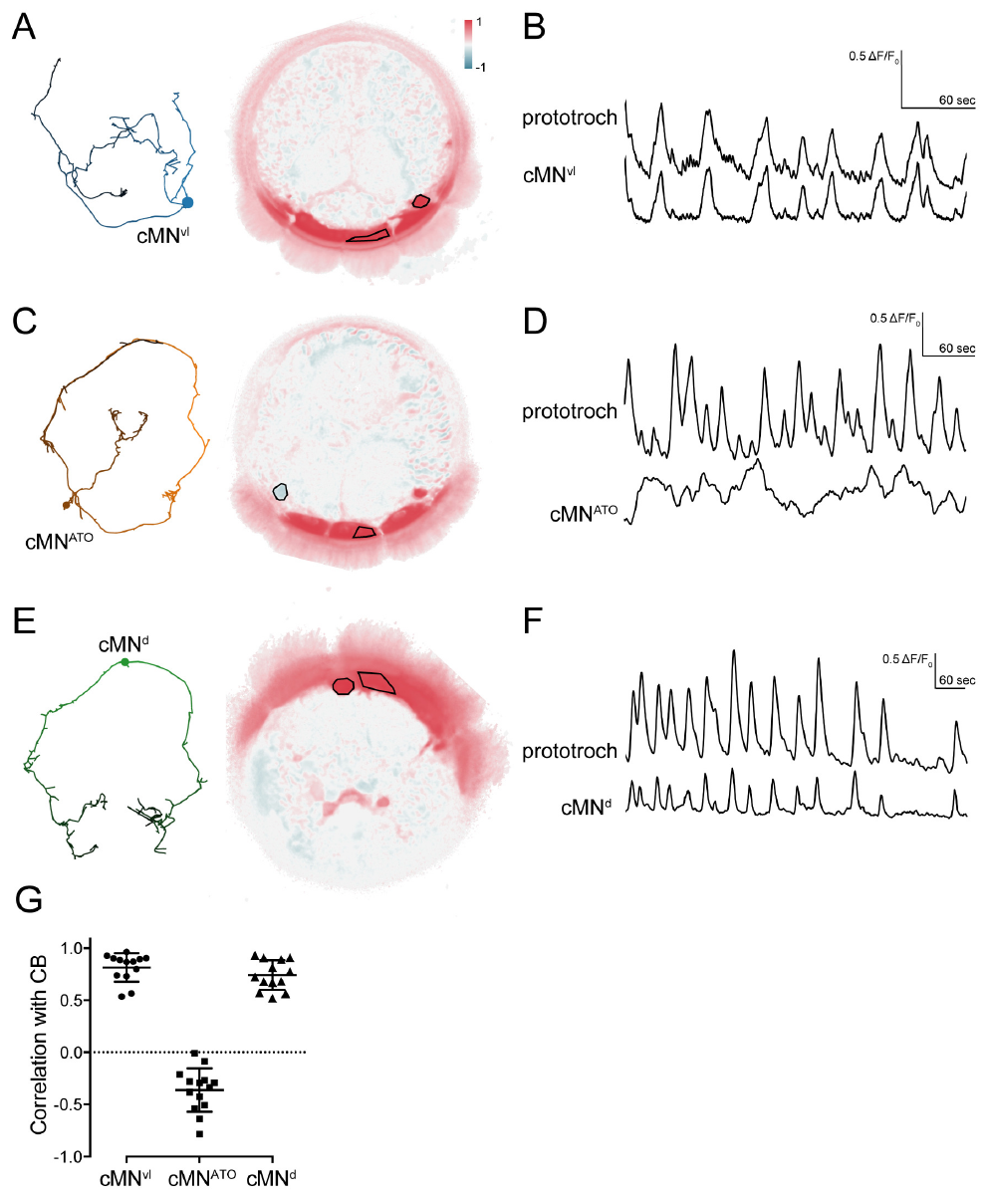
Identified ciliomotor cells occupy different phases
Verasztó and colleagues imaged identified ciliomotor neurons and the prototroch with GCaMP6s, a genetically encoded calcium-sensitive fluorescent protein. In 2-day-old larvae, cell position and reconstructed morphology linked each recorded cell to the anatomical circuit.
Fluorescence in cMNvl and cMNd, two catecholaminergic ciliomotor cells, rose in step with the ciliary band. The cMNATO cell tended to vary in the opposite direction. Catecholaminergic identity marks a transmitter-related molecular class, while the functional sign of each cell comes from its activity pattern.
These phase relationships place the neurons in populations with different timing within the coordinated rhythm. Calcium fluorescence integrates activity over time, so opposite phases show differentiated circuit participation rather than the millisecond timing of individual spikes.
Verasztó et al. (2017), Fig. 6(A–G). Identified ciliomotor cells and calcium phase relations.
Verasztó et al. (2017)
19
Notes:
• Verasztó and colleagues imaged identified ciliomotor neurons and the prototroch using GCaMP6s, a genetically encoded calcium-sensitive fluorescent protein. In 2-day-old larvae, cell position and reconstructed morphology linked the recorded cells to the anatomical circuit.
• Two catecholaminergic ciliomotor cells, labeled cMNvl and cMNd, increased fluorescence in phase with the ciliary band. The cMNATO cell instead tended to vary oppositely. Catecholaminergic identifies a transmitter-related molecular class; it does not by itself specify the functional sign of a recorded cell.
– The fluorescence and anatomical identification are combined to avoid assigning a signal to an unknown neighboring cell. A cell that is active at the opposite phase may participate in a competing circuit state, but that possibility remains different from a demonstrated inhibitory synapse. Timing and synaptic action require separate evidence.
• These phase relationships separate neuron populations with different timing in the coordinated rhythm. Calcium fluorescence integrates cellular activity over time and is not a direct millisecond spike recording. Opposite phases therefore support differentiated circuit participation without proving that one cell directly inhibits another or establishing the causal contribution of each transmitter.
References:
Csaba Verasztó; Nobuo Ueda; Luis A Bezares-Calderón; Aurora Panzera; Elizabeth A Williams; Réza Shahidi; Gáspár Jékely (2017). Ciliomotor circuitry underlying whole-body coordination of ciliary activity in the Platynereis larva. eLife 6: e26000. https://doi.org/10.7554/elife.26000
Figure: Verasztó et al. (2017), Fig. 6(A–G). Identified ciliomotor cells and calcium phase relations.
Figure source: https://doi.org/10.7554/elife.26000

Slide 26
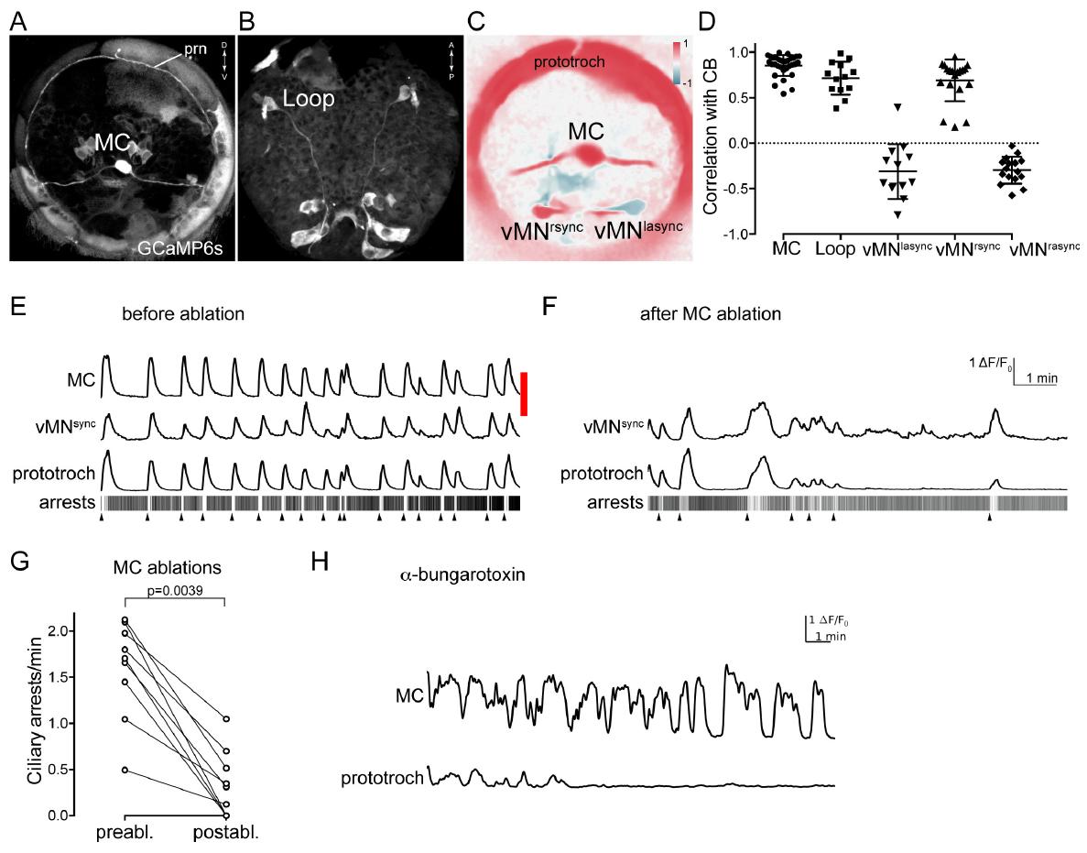
Ablation separates rhythm generation from its output
Ablation destroys a chosen cell so that its contribution can be tested. Verasztó and colleagues used a pulsed laser to ablate the identified MC neuron, then compared prototroch calcium activity and ciliary arrests before and after the procedure. Calcium activity and arrests were the two readouts of the rhythm.
Removing MC abolished the prominent rhythmic prototroch activity and sharply cut the number of arrests. In intact imaged preparations the MC calcium cycle had a median period of about 71 s. Blocking nicotinic acetylcholine receptors with α-bungarotoxin uncoupled the ciliary response, while the MC neuron kept cycling.
The two interventions distinguish the source of rhythmic neuronal activity from the cholinergic transmission that drives the effector. The MC neuron therefore contributes both to the rhythm and to its receptor-dependent output, and the reconstructed network contains additional cholinergic neurons that also feed into arrests.
Verasztó et al. (2017), Fig. 7(A–H). MC-cell ablation and cholinergic blockade alter ciliary activity.
Verasztó et al. (2017)
20
Notes:
• Ablation removes or destroys a selected cell to test its contribution. Verasztó and colleagues used a pulsed laser to ablate the identified MC neuron, then compared prototroch calcium activity and ciliary arrests before and after the intervention.
• MC ablation removed the prominent rhythmic prototroch activity and greatly reduced arrests. The MC calcium cycle had a median period near 71 s in intact imaged preparations. Blocking nicotinic acetylcholine receptors, transmitter-activated ion channels, with α-bungarotoxin uncoupled the ciliary response while the MC neuron continued to cycle.
– Removing a neuron changes the circuit itself, whereas blocking a receptor can leave the upstream neuronal rhythm intact. A preserved MC signal with a lost ciliary response localizes a required transmission step downstream of that rhythm. Residual low-rate activity after ablation also limits a claim that no other cell can activate the prototroch.
• The complementary interventions distinguish the source of rhythmic neuronal activity from cholinergic transmission to the effector. They support MC participation and receptor-dependent output. They do not establish that MC is the sole contributor to every arrest, because residual activity remained and the reconstructed network contained additional cholinergic neurons.
References:
Csaba Verasztó; Nobuo Ueda; Luis A Bezares-Calderón; Aurora Panzera; Elizabeth A Williams; Réza Shahidi; Gáspár Jékely (2017). Ciliomotor circuitry underlying whole-body coordination of ciliary activity in the Platynereis larva. eLife 6: e26000. https://doi.org/10.7554/elife.26000
Figure: Verasztó et al. (2017), Fig. 7(A–H). MC-cell ablation and cholinergic blockade alter ciliary activity.
Figure source: https://doi.org/10.7554/elife.26000

Slide 27
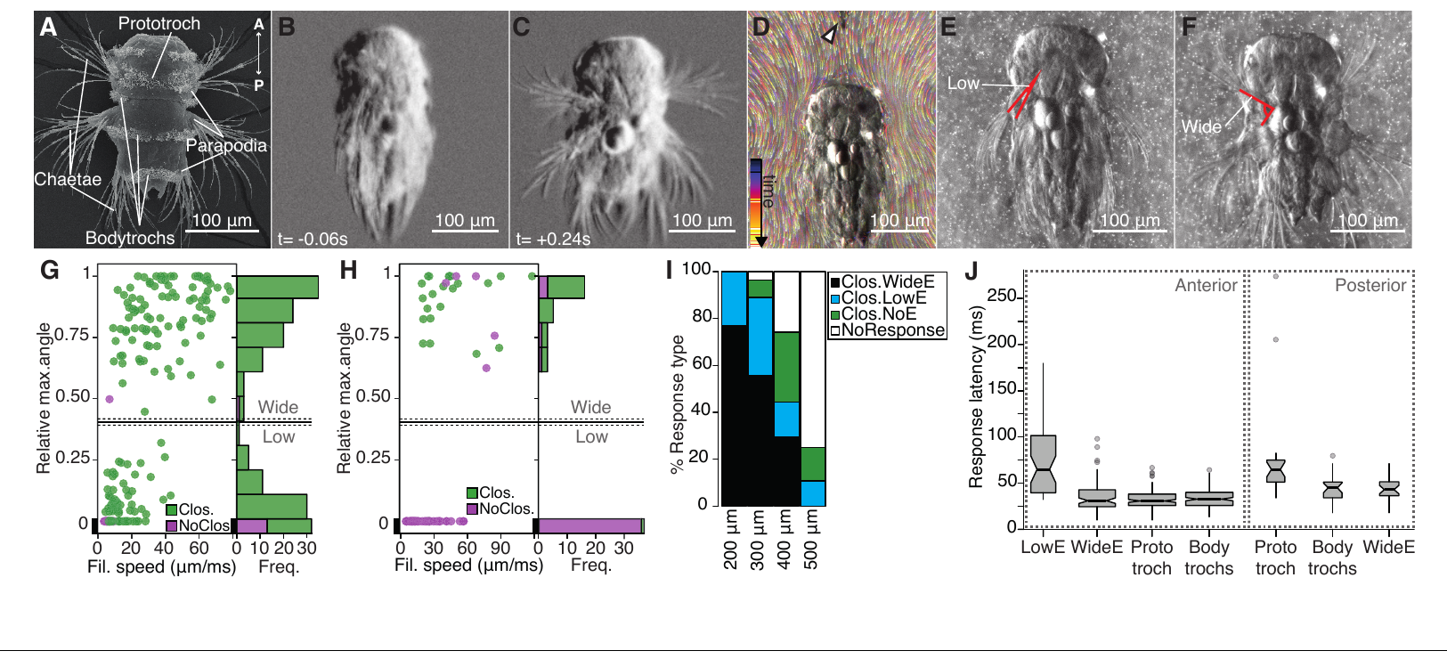
Water disturbance recruits coordinated larval defense
A hydrodynamic stimulus moves water locally and can deform sensory structures. Bezares-Calderón and colleagues tested Platynereis larvae with a vibrating tungsten filament and observed ciliary arrest, body contraction and elevation of paired appendages called parapodia.
High-speed recordings at 230 to 350 frames per second resolved the response. Faster filaments pushed the appendages into a wider elevation, and a filament placed farther from the head had to move more forcefully to trigger it. Wide elevation was consistently recruited above about 28 µm/ms under the arrangement tested.
The controlled stimulus ties local water movement to a coordinated defensive action. The dependence on distance supports near-field sensing, in which receptors respond to water movement close to the body. Filament speed is the mechanical parameter the experimenter sets, so it provides an input that can be varied and measured.
Bezares-Calderón et al. (2018), Fig. 1(A–J). Hydrodynamic stimulus and larval startle kinematics.
Bezares-Calderón et al. (2018)
21
Notes:
• A hydrodynamic stimulus is a local movement of water that can deform sensory structures. Bezares-Calderón and colleagues tested Platynereis larvae with a vibrating tungsten filament, observing ciliary arrest, body contraction and elevation of paired appendages called parapodia.
• High-speed recordings at 230–350 frames/s resolved the response. Increasing filament speed favored wider appendage elevation, and placing the filament farther from the head required stronger stimulation. Wide elevation was consistently recruited above approximately 28 µm/ms under the tested arrangement.
– The filament is placed near the larva without delivering a direct touch to its body. Fluorescent beads helped characterize the surrounding flow. Ciliary arrest reduces ongoing swimming while elevated appendages change body configuration, so the defensive response combines multiple effectors rather than one isolated reflex.
• The controlled stimulus links local water movement to a coordinated defensive action. Filament speed is the imposed mechanical parameter, not a direct measurement of the water velocity at each receptor. The dependence on distance supports near-field sensing, but behavior alone cannot identify the sensory channel or the neurons transmitting the response.
References:
Luis A Bezares-Calderón; Jürgen Berger; Sanja Jasek; Csaba Verasztó; Sara Mendes; Martin Gühmann; Rodrigo Almeda; Réza Shahidi; Gáspár Jékely (2018). Neural circuitry of a polycystin-mediated hydrodynamic startle response for predator avoidance. eLife 7: e36262. https://doi.org/10.7554/elife.36262
Figure: Bezares-Calderón et al. (2018), Fig. 1(A–J). Hydrodynamic stimulus and larval startle kinematics.
Figure source: https://doi.org/10.7554/elife.36262

Slide 28
Filament speed sets the startle response
Bezares-Calderón and colleagues moved a vibrating tungsten filament past Platynereis larvae and recorded the movements at 230 to 350 frames per second. The startle included ciliary arrest, body contraction and elevation of the parapodia. Several of these movements occurred together in each response.
Increasing filament speed favored wider appendage elevation. Placing the filament farther from the head required stronger stimulation, which indicates sensing at short range. Wide elevation was consistently recruited above about 28 µm/ms, and that speed marks the recruitment threshold.
The arrangement therefore links a defined water movement to a coordinated defensive action. The filament speed is the mechanical parameter the experimenter controls, so it provides an input that can be varied and measured across trials. Varying that input changes which appendage movements the larva produces.
Bezares-Calderón et al. (2018), Fig. 1(A–J). Hydrodynamic stimulus and larval startle kinematics.
Bezares-Calderón et al. (2018)
21a
Notes:
• Filament speed sets the startle response.
• Explanation 1.
– Bezares-Calderón and colleagues moved a vibrating tungsten filament past Platynereis larvae and recorded the movements at 230 to 350 frames per second
– The startle included ciliary arrest, body contraction and elevation of the parapodia. Several of these movements occurred together in each response.
• Explanation 2.
– Increasing filament speed favored wider appendage elevation
– Placing the filament farther from the head required stronger stimulation, which indicates sensing at short range. Wide elevation was consistently recruited above about 28 µm/ms, and that speed marks the recruitment threshold.
• Explanation 3.
– The arrangement therefore links a defined water movement to a coordinated defensive action
– The filament speed is the mechanical parameter the experimenter controls, so it provides an input that can be varied and measured across trials. Varying that input changes which appendage movements the larva produces.
• Stimulus.
– A vibrating tungsten filament moved water around the larva.
– Responses were recorded at 230 to 350 frames per second.
• Speed.
– Faster filaments favored wider parapodia elevation.
– Wide elevation was recruited above about 28 µm/ms.
• Distance.
– Filaments placed farther from the head needed stronger stimulation.
– The result indicates sensing at short range.
• Meaning.
– A defined water movement drives a coordinated defensive action.
– Filament speed is the controlled input.
References:
Luis A Bezares-Calderón; Jürgen Berger; Sanja Jasek; Csaba Verasztó; Sara Mendes; Martin Gühmann; Rodrigo Almeda; Réza Shahidi; Gáspár Jékely (2018). Neural circuitry of a polycystin-mediated hydrodynamic startle response for predator avoidance. eLife 7: e36262. https://doi.org/10.7554/elife.36262

Slide 29
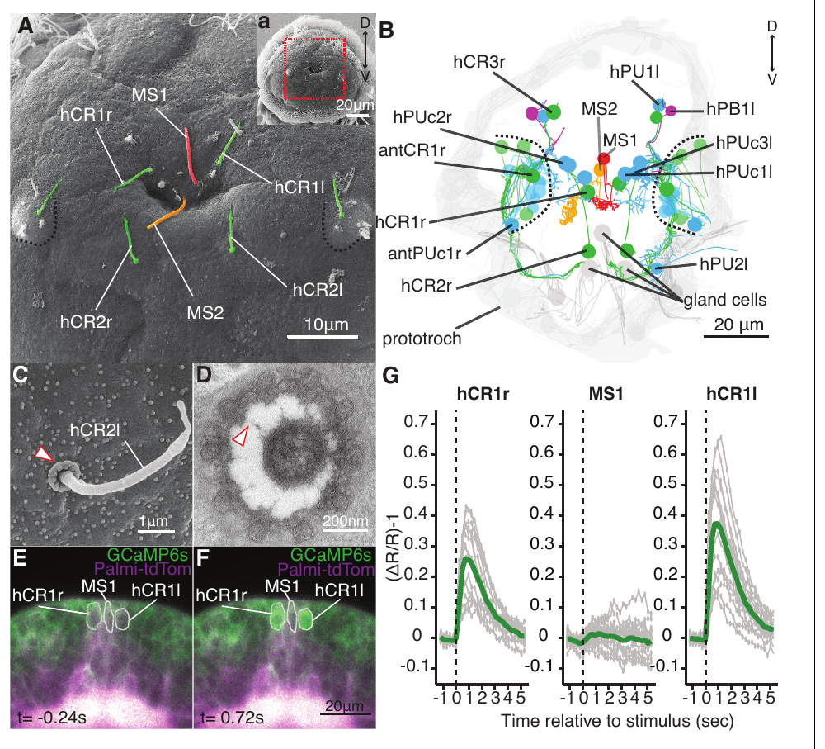
Collar receptors respond to local water movement
Each collar-receptor neuron bears a sensory cilium ringed by microvilli, which are small projections that form a collar. Bezares-Calderón and colleagues combined electron microscopy with calcium imaging to find these sensory cells in the head of Platynereis larvae.
One collar contained ten thick microvilli linked to the projecting cilium by fine fibers. A vibrating filament placed about 50 µm in front of the head increased calcium-indicator fluorescence in identified head collar receptors. A nearby sensory neuron with a different morphology served as a comparison in the same recording.
The anatomy and the stimulus-evoked activity together support mechanosensory input through these cells. Calcium imaging identifies which sensory population becomes active, while molecular expression and genetic disruption show which proteins the behavioral response requires.
Bezares-Calderón et al. (2018), Fig. 2(A–G). Collar-receptor anatomy, ultrastructure and stimulus-evoked calcium.
Bezares-Calderón et al. (2018)
22
Notes:
• Collar-receptor neurons carry a sensory cilium surrounded by microvilli, small cellular projections that form a collar. Bezares-Calderón and colleagues combined electron microscopy with calcium imaging to identify these sensory cells in the head of Platynereis larvae.
• A collar included ten thick microvilli linked to the projecting cilium by fine fibers. A vibrating filament placed about 50 µm anterior to the head increased calcium-indicator fluorescence in identified head collar receptors. A nearby morphologically different sensory neuron supplied a comparison in the same recording.
– The projecting cilium and its collar cross the body covering and can interact with surrounding water. Recording neighboring identified cells at the same time helps distinguish a selective response from a global imaging fluctuation. Ultrastructure specifies a candidate mechanical arrangement but does not itself measure channel gating.
• The anatomical arrangement and stimulus-evoked activity support a mechanosensory input through these cells. They do not directly measure force opening a specific channel. Calcium imaging identifies an activated sensory population, while molecular expression and genetic disruption are needed to test which proteins are required for the behavioral response.
References:
Luis A Bezares-Calderón; Jürgen Berger; Sanja Jasek; Csaba Verasztó; Sara Mendes; Martin Gühmann; Rodrigo Almeda; Réza Shahidi; Gáspár Jékely (2018). Neural circuitry of a polycystin-mediated hydrodynamic startle response for predator avoidance. eLife 7: e36262. https://doi.org/10.7554/elife.36262
Figure: Bezares-Calderón et al. (2018), Fig. 2(A–G). Collar-receptor anatomy, ultrastructure and stimulus-evoked calcium.
Figure source: https://doi.org/10.7554/elife.36262

Slide 30
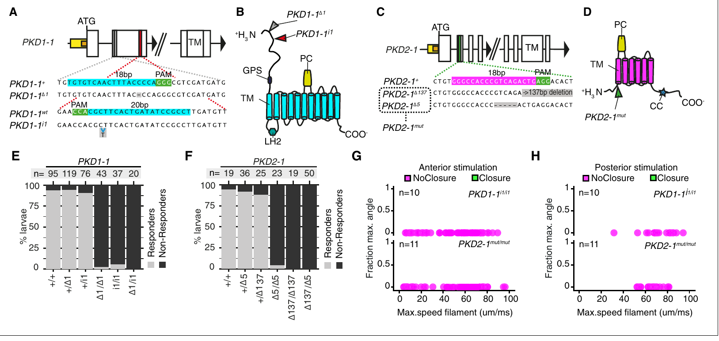
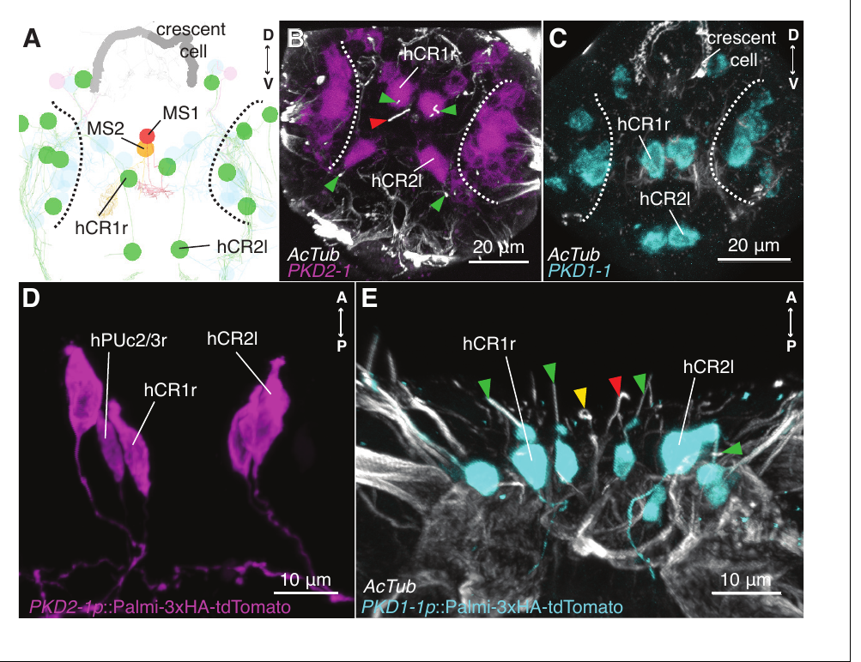
Polycystin mutations disrupt startle and protection
Polycystins are a protein family with candidate components for mechanosensory signaling. Bezares-Calderón and colleagues detected PKD1-1 and PKD2-1 expression in larval collar-receptor neurons, then generated inherited loss-of-function mutations with targeted genome editing.
Larvae homozygous for either mutation produced abnormal startle responses to the vibrating filament instead of the normal coordinated response. Sensory-cell morphology was preserved, which argues against a simple loss of the entire receptor cell. Predatory copepods, which are small planktonic crustaceans, caught PKD2-1 mutants more easily in predator tests.
The genetic result shows that PKD1-1 and PKD2-1 are required in the pathway that carries the filament stimulus from sensory cell to behavior. Recordings of mechanically activated current are the measurement that would show how force reaches these proteins.
Bezares-Calderón et al. (2018), Fig. 4(A–H). Polycystin mutations abolish the hydrodynamic startle response.
Bezares-Calderón et al. (2018), Fig. 3(A–E). PKD1-1 and PKD2-1 expression in collar-receptor neurons.
Bezares-Calderón et al. (2018)
23
Notes:
• Polycystins are a protein family containing candidate components of mechanosensory signaling. Bezares-Calderón and colleagues detected PKD1-1 and PKD2-1 expression in larval collar-receptor neurons, then generated inherited loss-of-function mutations using targeted genome editing.
• Larvae homozygous for either mutation failed to produce normal coordinated startle responses to the vibrating filament. Sensory-cell morphology was retained, arguing against a simple loss of the entire receptor cell. In predator tests, PKD2-1 mutants were captured more readily by predatory copepods, small planktonic crustaceans.
– Homozygous mutant larvae carry the disrupted form on both inherited copies of the gene. Expression identifies the candidate sensory location, while the mutation tests whether the protein is required. The predator assay connects the laboratory startle deficit to a consequence during an encounter with a real predator.
• The genetic result establishes a requirement for these proteins in this sensory-to-behavior pathway. It does not establish directly that force gates a PKD1-1/PKD2-1 complex. Impaired detection, altered signal transmission or another channel-related contribution remain possible molecular explanations without direct recordings of mechanically activated current.
References:
Luis A Bezares-Calderón; Jürgen Berger; Sanja Jasek; Csaba Verasztó; Sara Mendes; Martin Gühmann; Rodrigo Almeda; Réza Shahidi; Gáspár Jékely (2018). Neural circuitry of a polycystin-mediated hydrodynamic startle response for predator avoidance. eLife 7: e36262. https://doi.org/10.7554/elife.36262
Figure: Bezares-Calderón et al. (2018), Fig. 4(A–H). Polycystin mutations abolish the hydrodynamic startle response.
Figure source: https://doi.org/10.7554/elife.36262
Figure: Bezares-Calderón et al. (2018), Fig. 3(A–E). PKD1-1 and PKD2-1 expression in collar-receptor neurons.
Figure source: https://doi.org/10.7554/elife.36262

Slide 31
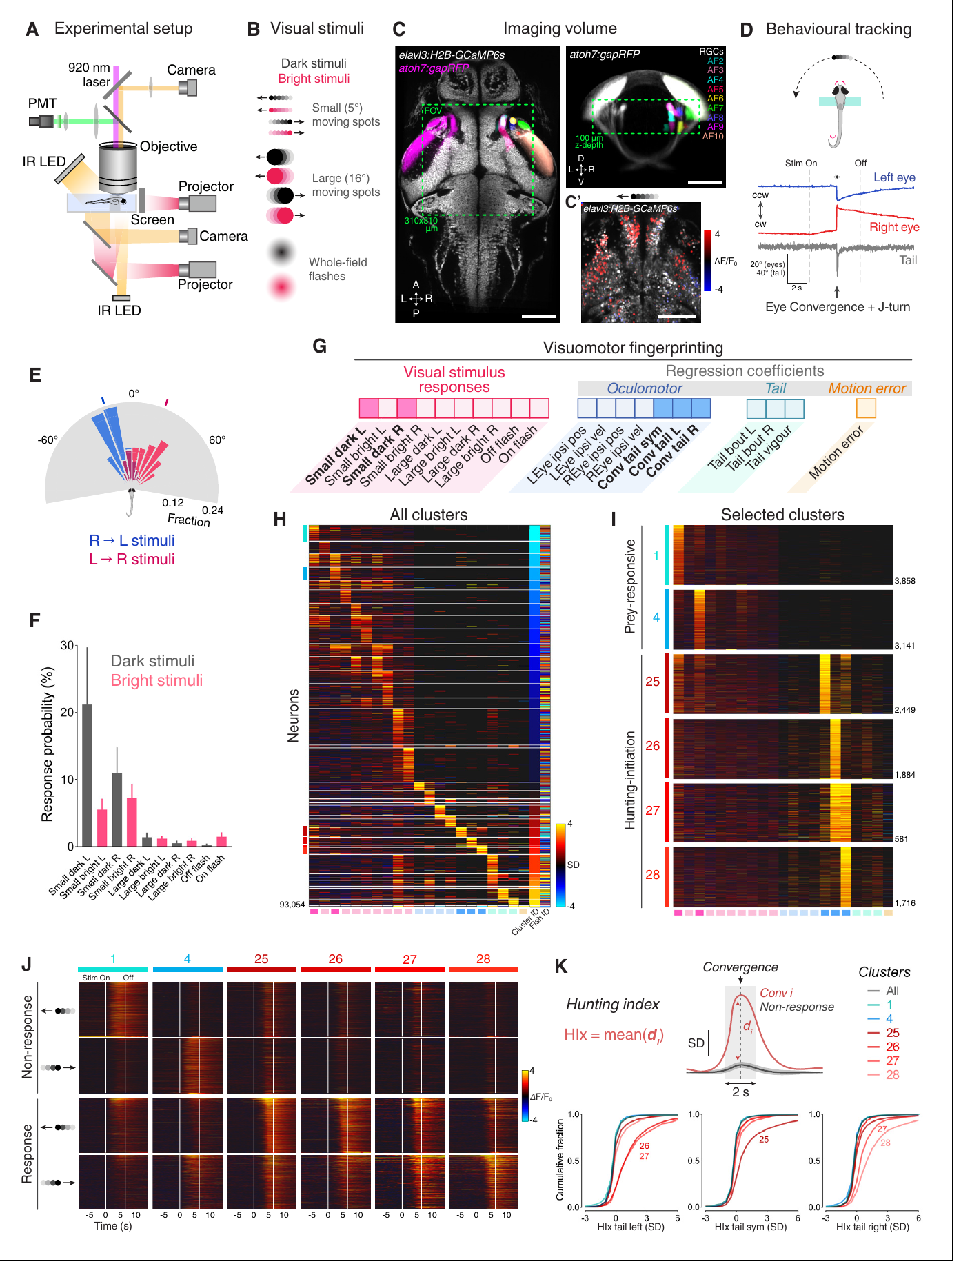
Hunting begins with coordinated eye and tail movements
Larval zebrafish hunt small moving prey with a coordinated sequence of eye and body movements. Eye convergence rotates both eyes toward a common frontal region. A saccade is a rapid eye movement, and convergent saccades provide a measurable marker of hunting initiation.
Antinucci and colleagues studied larvae 6 to 7 days after fertilization. In a partly restrained visual assay, small dark moving spots preferentially recruited convergence together with lateral tail movement. About 92% of convergent saccades coincided with tail motion, and the eye-to-tail delay averaged near 12 ms.
Two-photon calcium imaging recorded brain activity while the eyes and tail stayed mobile, which ties controlled visual input to the movements of the hunt. Free-swimming activation and ablation experiments then supplied complementary behavioral tests in fully mobile larvae.
Antinucci et al. (2019), Fig. 1(A–K). Hunting-related calcium activity, eye convergence and brain anatomy.
Antinucci et al. (2019)
24
Notes:
• Larval zebrafish hunt small moving prey using a coordinated sequence of eye and body movements. Eye convergence rotates the eyes toward a common frontal region. A saccade is a rapid eye movement; convergent saccades provide a measurable marker of hunting initiation.
• Antinucci and colleagues studied larvae 6–7 days after fertilization. During a partially restrained visual assay, small dark moving spots preferentially recruited convergence together with lateral tail movement. Approximately 92% of convergent saccades coincided with tail motion, with an average eye-to-tail delay near 12 ms.
– Two-photon imaging uses focused excitation to measure fluorescence in a selected tissue volume. The larva can move its eyes and tail even though part of its body is restrained. Eye convergence distinguishes a hunting-related motor transition from a generic tail movement, so it supports more specific activity–behavior comparisons.
• Two-photon calcium imaging measured brain activity while the eyes and tail remained mobile. The preparation links controlled visual input to hunting-related movements, but does not retain the full sensory and mechanical conditions of prey capture. Free-swimming activation and ablation experiments supplied complementary behavioral tests.
References:
Paride Antinucci; Mónica Folgueira; Isaac H Bianco (2019). Pretectal neurons control hunting behaviour. eLife 8: e48114. https://doi.org/10.7554/elife.48114
Figure: Antinucci et al. (2019), Fig. 1(A–K). Hunting-related calcium activity, eye convergence and brain anatomy.
Figure source: https://doi.org/10.7554/elife.48114

Slide 32
Eye convergence marks the start of hunting
Larval zebrafish that spot small moving prey converge their eyes toward a common frontal region. In the study by Antinucci and colleagues, convergent saccades served as the measurable marker that hunting had begun. A saccade is a rapid eye movement, so each convergent saccade can be counted as the start of a hunt.
Larvae 6 to 7 days after fertilization produced convergence together with lateral tail movement in response to small dark moving spots. About 92% of convergent saccades coincided with tail motion, and the eye-to-tail delay averaged near 12 ms. Small dark spots were the stimulus that most reliably recruited the combined movement.
Two-photon calcium imaging recorded brain activity during these movements in the restrained preparation. Pretectal neurons were then tested for their role in hunting through activation and ablation in larvae that moved freely. Those experiments used free-swimming larvae to test the behavior under fewer constraints.
Antinucci et al. (2019), Fig. 1(A–K). Hunting-related calcium activity, eye convergence and brain anatomy.
Antinucci et al. (2019)
24a
Notes:
• Eye convergence marks the start of hunting.
• Explanation 1.
– Larval zebrafish that spot small moving prey converge their eyes toward a common frontal region
– In the study by Antinucci and colleagues, convergent saccades served as the measurable marker that hunting had begun. A saccade is a rapid eye movement, so each convergent saccade can be counted as the start of a hunt.
• Explanation 2.
– Larvae 6 to 7 days after fertilization produced convergence together with lateral tail movement in response to small dark moving spots
– About 92% of convergent saccades coincided with tail motion, and the eye-to-tail delay averaged near 12 ms. Small dark spots were the stimulus that most reliably recruited the combined movement.
• Explanation 3.
– Two-photon calcium imaging recorded brain activity during these movements in the restrained preparation
– Pretectal neurons were then tested for their role in hunting through activation and ablation in larvae that moved freely. Those experiments used free-swimming larvae to test the behavior under fewer constraints.
• Behavior.
– Larval zebrafish converge their eyes toward a frontal region when prey appears.
– Convergent saccades mark the start of hunting.
• Timing.
– About 92% of convergent saccades coincided with tail motion.
– The eye-to-tail delay averaged near 12 ms.
• Imaging.
– Two-photon calcium imaging recorded activity in the restrained preparation.
– Eyes and tails stayed mobile during recording.
• Follow-up.
– Activation and ablation tests were run in free-swimming larvae.
– They addressed the role of pretectal neurons.
References:
Paride Antinucci; Mónica Folgueira; Isaac H Bianco (2019). Pretectal neurons control hunting behaviour. eLife 8: e48114. https://doi.org/10.7554/elife.48114

Slide 33
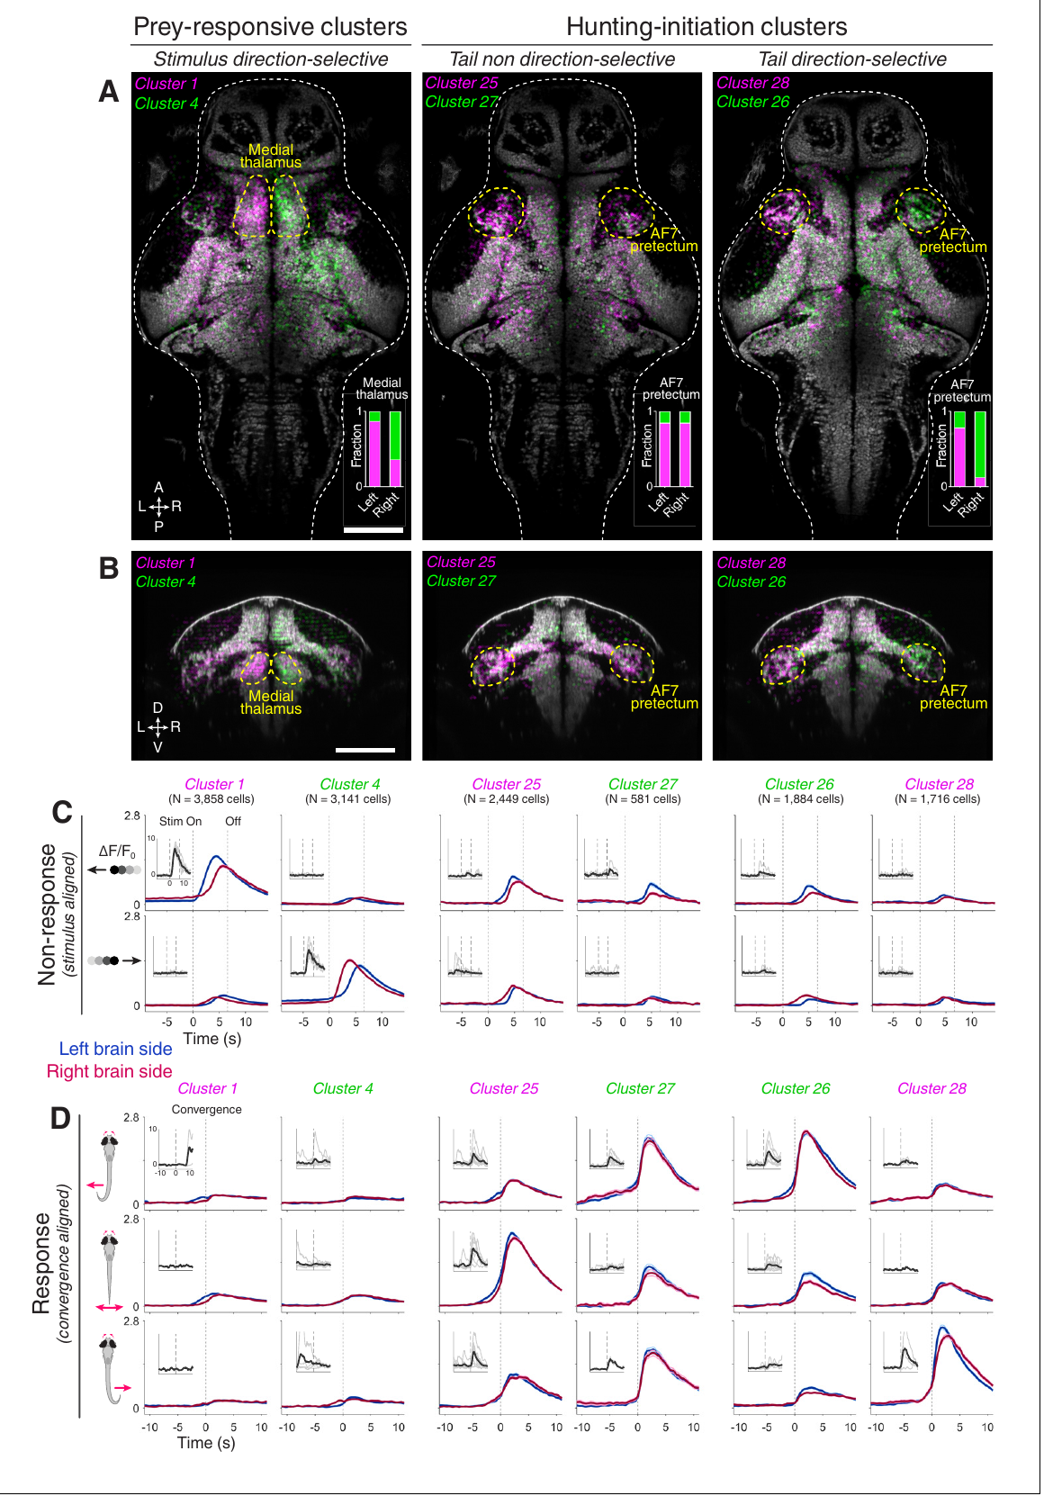
Pretectal populations separate prey input from action
Lying close to the retinal input sites and the optic tectum, the pretectum is a visual brain region. Retinal ganglion cells carry signals from the eye into the brain, and their axons end in regions called arborization fields. Activity was mapped around the AF7 input region by Antinucci and colleagues.
Calcium responses were measured for prey-like stimuli that evoked convergence and for those that failed to evoke it. Prey-responsive cells followed the visual input, whereas other clusters were more strongly tied to the start of hunting. Their distributions overlapped near AF7 and diverged across the surrounding brain.
This split distinguishes a response to the sensory event from a response tied to the animal's own action. A neuron active near movement onset may contribute to initiation, may receive a related command, or may respond to the movement that follows, and targeted interventions decide among these options.
Antinucci et al. (2019), Fig. 2(A–D). Pretectal hunting-initiation clusters in the larval brain.
Antinucci et al. (2019)
25
Notes:
• The pretectum is a visual brain region near retinal input sites and the optic tectum. Retinal ganglion cells carry output from the eye into the brain; their axons terminate in regions called arborization fields. Antinucci and colleagues mapped activity around the AF7 input region.
• Calcium responses were compared between prey-like stimulus presentations that did and did not evoke hunting-related convergence. Prey-responsive cells followed visual input, whereas other clusters were more strongly associated with hunting initiation. Their anatomical distributions overlapped near AF7 but differed across the surrounding brain.
– The same visual stimulus can occur on a response trial and a non-response trial. Comparing those trials prevents every stimulus-related signal from being labeled a hunting command. The anatomical mapping also prevents functionally different cells close to the same retinal input site from being treated as one uniform population.
• The dissociation distinguishes a response to the sensory event from a response associated with the animal’s action. It does not establish causation from calcium activity alone. A neuron active near movement onset could contribute to initiation, receive a related command or respond to the resulting movement; targeted interventions distinguish these possibilities.
References:
Paride Antinucci; Mónica Folgueira; Isaac H Bianco (2019). Pretectal neurons control hunting behaviour. eLife 8: e48114. https://doi.org/10.7554/elife.48114
Figure: Antinucci et al. (2019), Fig. 2(A–D). Pretectal hunting-initiation clusters in the larval brain.
Figure source: https://doi.org/10.7554/elife.48114

Slide 34
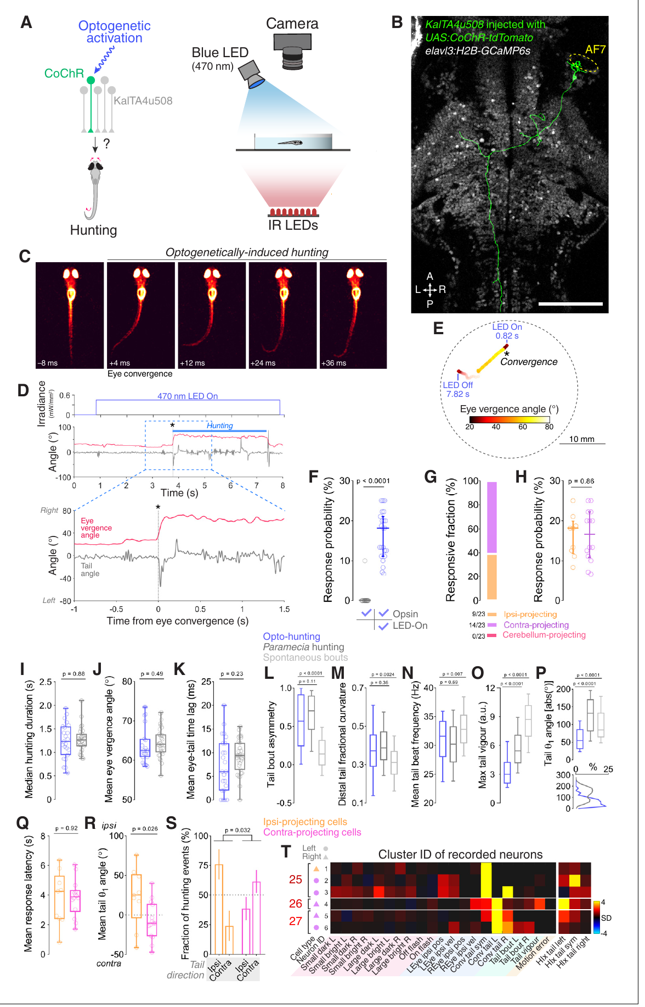
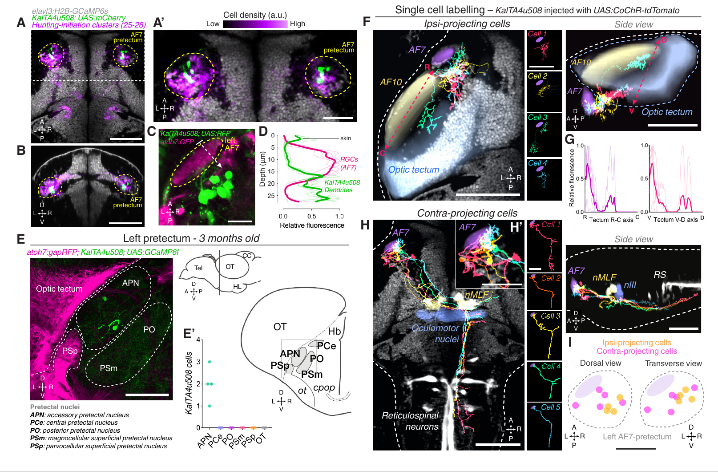
Activating one pretectal cell can recruit hunting
CoChR, a light-gated cation channel, was expressed by Antinucci and colleagues in single genetically accessible pretectal neurons. Cell morphology identified each targeted neuron, and high-speed video quantified free-swimming responses during repeated 7 s blue-light periods.
Illumination at 470 nm and 0.44 mW/mm² led some single-cell preparations to produce eye convergence, lateralized swim bouts and sustained hunting-like routines without prey. Responsive preparations had a median response probability near 18% during illumination, while light-off trials produced zero such events.
Opsin-negative controls showed no hunting under blue light alone, so the response depends on the opsin. The activated routine includes eye convergence followed by lateralized swimming, which means that a single identified cell can recruit a coordinated motor program.
Antinucci et al. (2019), Fig. 3(A–I). Single pretectal-cell morphology and projection classes.
Antinucci et al. (2019), Fig. 5(A–T). Single-neuron optical activation and hunting-like kinematics.
Antinucci et al. (2019)
26
Notes:
• Antinucci and colleagues expressed CoChR, a light-gated cation channel, in individual genetically accessible pretectal neurons. Cell morphology identified the targeted neuron, and high-speed video quantified free-swimming responses during repeated 7-s blue-light stimulation periods.
• Illumination at 470 nm and 0.44 mW/mm² caused some single-cell preparations to produce eye convergence followed by lateralized swim bouts and sustained hunting-like routines without prey. Responsive preparations had a median response probability near 18% during illumination, compared with zero in the corresponding light-off trials.
– The behavioral sequence is classified from coordinated eye and tail kinematics rather than from one movement alone. The stimulated cell remains embedded in an intact downstream circuit, so sufficiency of its activation does not mean that one neuron executes the entire program without other neurons. The morphology identifies where the stimulated cell projects.
• Opsin-negative controls did not display hunting in response to the blue light alone. Single-cell activation therefore supports sufficiency for recruitment of a coordinated motor program. The incomplete response probability and absence of prey limit any claim that the intervention reproduces every aspect of a naturally initiated hunt.
References:
Paride Antinucci; Mónica Folgueira; Isaac H Bianco (2019). Pretectal neurons control hunting behaviour. eLife 8: e48114. https://doi.org/10.7554/elife.48114
Figure: Antinucci et al. (2019), Fig. 5(A–T). Single-neuron optical activation and hunting-like kinematics.
Figure source: https://doi.org/10.7554/elife.48114
Figure: Antinucci et al. (2019), Fig. 3(A–I). Single pretectal-cell morphology and projection classes.
Figure source: https://doi.org/10.7554/elife.48114

Slide 35
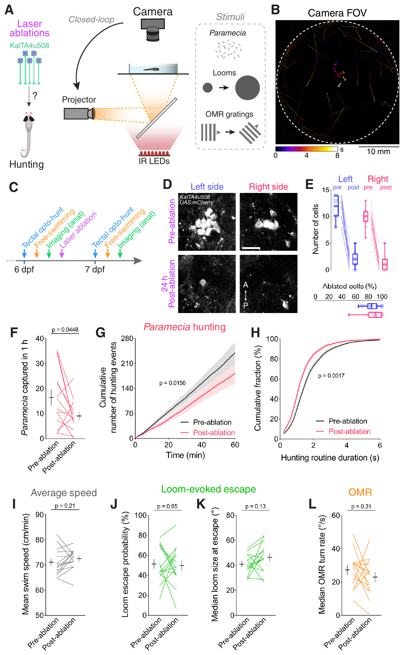
Pretectal ablation impairs hunting selectively
Necessity asks whether normal performance requires the tested component. At 6 days after fertilization, Antinucci and colleagues destroyed fluorescently labeled pretectal cells and then scored free-swimming behavior both before the procedure and the next day.
About 90% of the labeled population was removed. Prey consumption, hunting initiation and the duration of hunting sequences declined. Average swimming speed, escape responses to looming stimuli and the optomotor response, which is swimming driven by moving visual patterns, were retained. Sham ablations removed nearby thalamic cells instead.
The preserved behaviors show that the loss reflects a specific deficit in hunting rather than a general decline in movement or visual responsiveness. The pretectal population therefore contributes to the initiation and maintenance of normal hunting.
Antinucci et al. (2019), Fig. 6(A–L). Pretectal ablation with hunting, escape and optomotor controls.
Antinucci et al. (2019)
27
Notes:
• Necessity concerns whether normal performance requires the tested component. Antinucci and colleagues ablated fluorescently identified pretectal cells at 6 days after fertilization, then assessed free-swimming behavior before the intervention and on the following day.
• Approximately 90% of the labeled population was removed. Prey consumption, hunting initiation and hunting-sequence duration declined. Average swimming speed, escape responses to looming stimuli and the optomotor response, swimming driven by moving visual patterns, were retained. Sham ablations removed nearby thalamic cells instead.
– A sham intervention controls for a procedure while changing which tissue is damaged. Here nearby-cell ablations and handling-only comparisons helped constrain a general injury explanation. Reimaging verified cell loss, and intact retinal axons argued against destruction of the visual input itself.
• The preserved comparison behaviors argue against a general loss of movement or visual responsiveness. The result supports a contribution to normal hunting initiation and maintenance. It does not establish that every labeled cell has the same function, or that the residual population cannot support some remaining hunting under other conditions.
References:
Paride Antinucci; Mónica Folgueira; Isaac H Bianco (2019). Pretectal neurons control hunting behaviour. eLife 8: e48114. https://doi.org/10.7554/elife.48114
Figure: Antinucci et al. (2019), Fig. 6(A–L). Pretectal ablation with hunting, escape and optomotor controls.
Figure source: https://doi.org/10.7554/elife.48114

Slide 36
Pretectal loss spares swimming and escape
Antinucci and colleagues ablated about 90% of a fluorescently labeled pretectal population at 6 days after fertilization. Free-swimming larvae were tested before the procedure and again on the following day. Fluorescent labeling identified which cells were removed.
Prey consumption, hunting initiation and the duration of hunting sequences declined after the ablation. Average swimming speed, escape responses to looming stimuli and the optomotor response were retained. The optomotor response is swimming driven by moving visual patterns. Sham ablations of nearby thalamic cells were run as the control instead.
The spared behaviors indicate that the deficit is specific to hunting rather than a general loss of movement or visual responsiveness. The pretectal population contributes to the start and continuation of prey capture, and its loss leaves swimming and escape working normally.
Antinucci et al. (2019), Fig. 6(A–L). Pretectal ablation with hunting, escape and optomotor controls.
Antinucci et al. (2019)
27a
Notes:
• Pretectal loss spares swimming and escape.
• Explanation 1.
– Antinucci and colleagues ablated about 90% of a fluorescently labeled pretectal population at 6 days after fertilization
– Free-swimming larvae were tested before the procedure and again on the following day. Fluorescent labeling identified which cells were removed.
• Explanation 2.
– Prey consumption, hunting initiation and the duration of hunting sequences declined after the ablation
– Average swimming speed, escape responses to looming stimuli and the optomotor response were retained. The optomotor response is swimming driven by moving visual patterns. Sham ablations of nearby thalamic cells were run as the control instead.
• Explanation 3.
– The spared behaviors indicate that the deficit is specific to hunting rather than a general loss of movement or visual responsiveness
– The pretectal population contributes to the start and continuation of prey capture, and its loss leaves swimming and escape working normally.
• Ablation.
– About 90% of the labeled pretectal population was removed.
– Larvae were tested before and after the procedure.
• Deficit.
– Prey consumption and hunting initiation declined.
– Hunting-sequence duration also declined.
• Controls.
– Swimming speed and escape responses were retained.
– The optomotor response was also retained.
• Sham.
– Sham ablations removed nearby thalamic cells.
– That comparison isolates the pretectal population.
References:
Paride Antinucci; Mónica Folgueira; Isaac H Bianco (2019). Pretectal neurons control hunting behaviour. eLife 8: e48114. https://doi.org/10.7554/elife.48114

Slide 37
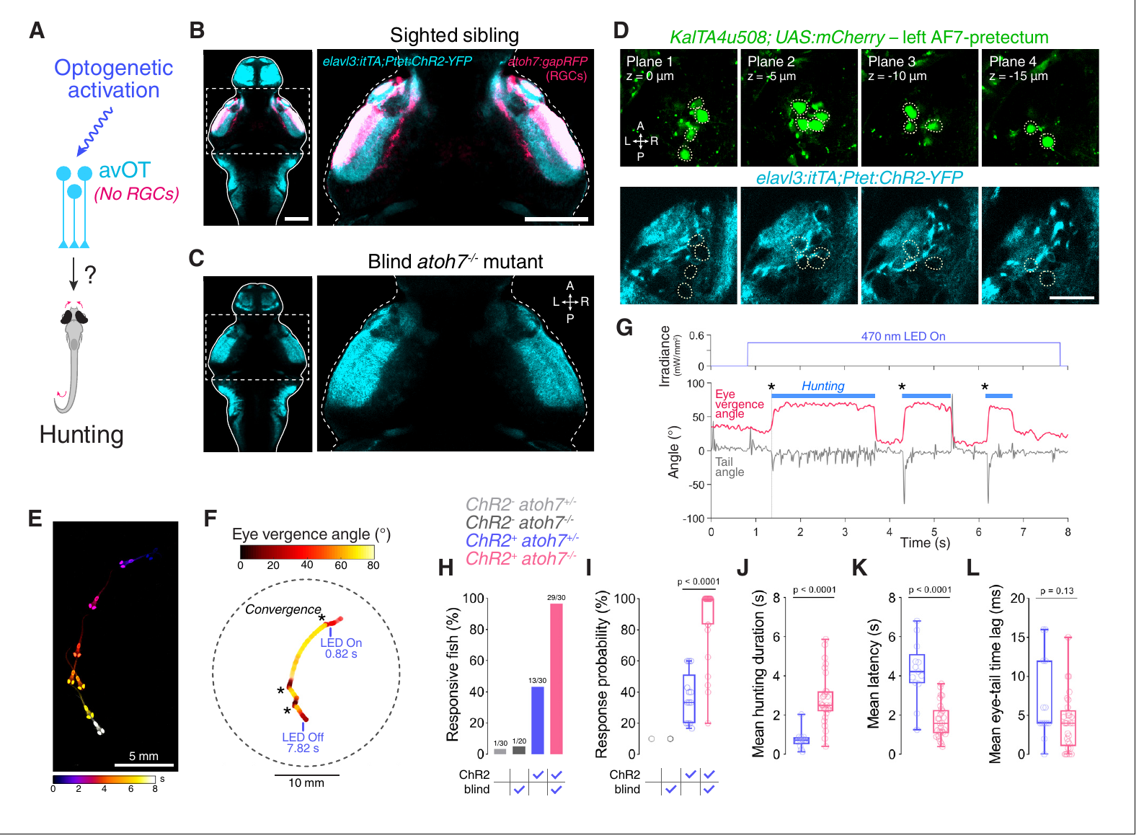
Tectal activation can recruit hunting without retinal input
The optic tectum is a midbrain region that takes part in visual and motor processing. Antinucci and colleagues stimulated a ChR2-expressing anterior-ventral tectal region and compared sighted larvae with mutants that lack retinal ganglion cells because of disrupted atoh7 function.
Blind larvae kept tectal ChR2 expression even though they lacked retinal input. Light stimulation evoked hunting-like behavior more easily in these mutants than in sighted siblings. Evoked routines kept eye convergence and lateralized tail movements, although response probability and duration differed between the groups.
Removing retinal input tests whether ordinary light-driven vision is required for the optically induced action, and the result shows that the action can be recruited through central circuitry. Retinal activation can therefore interfere with the assay itself.
Antinucci et al. (2019), Fig. 7(A–L). Tectal activation evokes hunting in larvae lacking retinal ganglion cells.
Antinucci et al. (2019)
28
Notes:
• The optic tectum is a midbrain region participating in visual and motor processing. Antinucci and colleagues stimulated a ChR2-expressing anterior-ventral tectal region, while comparing sighted larvae with mutants lacking retinal ganglion cells because of disrupted atoh7 function.
• Blind larvae retained tectal ChR2 expression despite losing retinal input. Optical stimulation recruited hunting-like behavior more readily in these mutants than in their sighted siblings. Evoked routines retained eye convergence and lateralized tail movements, although response probability and duration differed.
– Light in a sighted ChR2-expressing animal can both activate the actuator and stimulate normal photoreceptors. A blind sibling separates these two influences more directly than changing light intensity alone. Preserved central expression is required for interpreting that comparison; otherwise a change in actuator expression could explain the behavioral difference.
• Removing retinal input tests whether ordinary light-driven vision is required for the optically induced action. The result supports recruitment through central circuitry and indicates that retinal activation can interfere with the assay. It does not establish that vision is unnecessary for natural prey hunting or that the stimulated tectal population alone specifies the complete normal decision process.
References:
Paride Antinucci; Mónica Folgueira; Isaac H Bianco (2019). Pretectal neurons control hunting behaviour. eLife 8: e48114. https://doi.org/10.7554/elife.48114
Figure: Antinucci et al. (2019), Fig. 7(A–L). Tectal activation evokes hunting in larvae lacking retinal ganglion cells.
Figure source: https://doi.org/10.7554/elife.48114

Slide 38
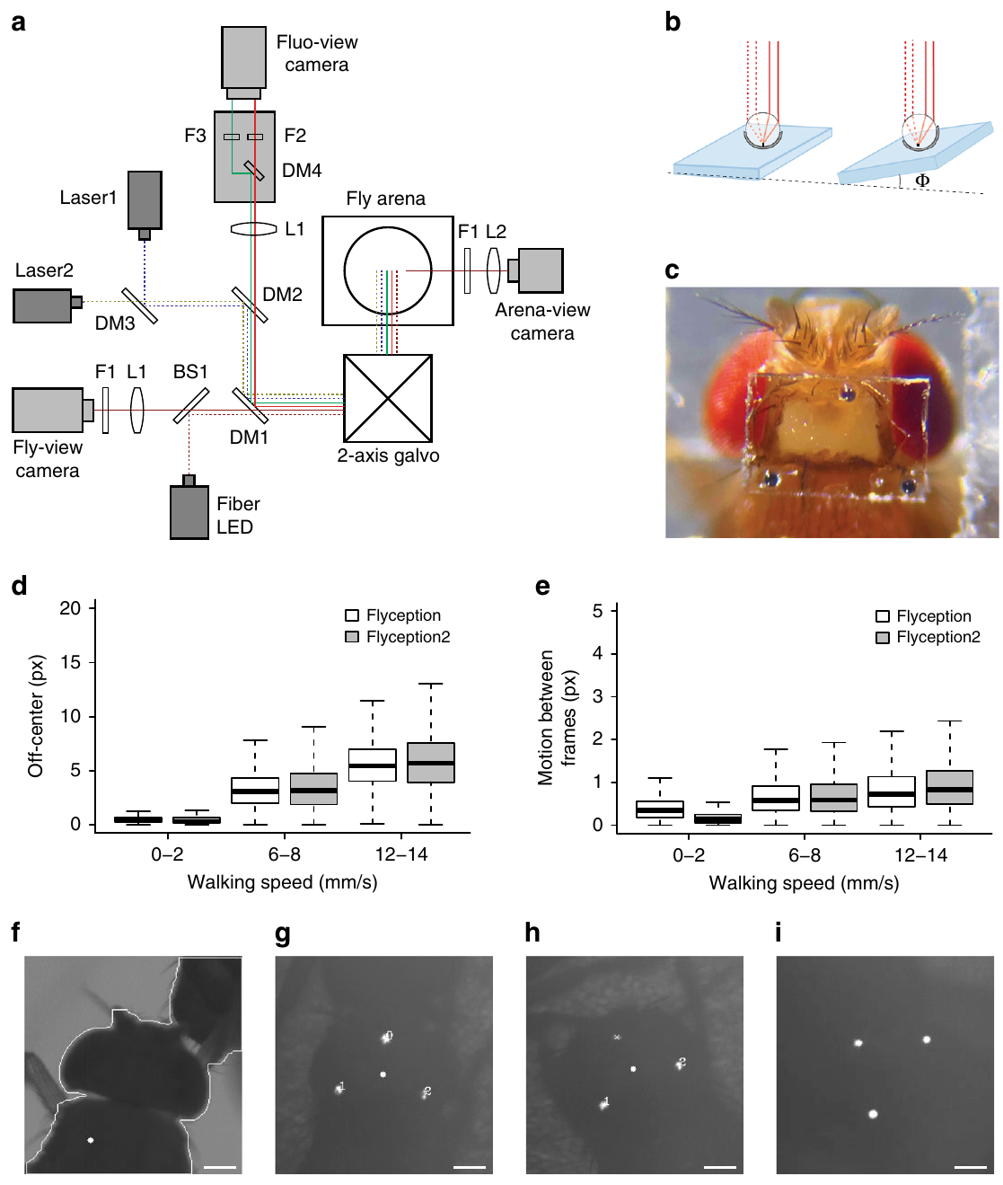
Tracking optics retain contact between untethered flies
Flyception2, an optical tracking system for brain fluorescence in freely moving adult flies, was developed by Grover and colleagues. The animal is untethered, meaning that no cable links it to the microscope, and external optics follow its head as it moves.
Three glass beads that reflect light, about 30 µm across, outlined a window over the brain. Mirror position was refreshed 1,000 times per second by a tracking loop. Retroreflection sends incoming light back toward its source, so the head stays identifiable when two flies' body outlines overlap.
Focus tracked the change in head height that occurred during courtship and copulation. The method keeps social contact in the measurement, which outline-based tracking had disrupted. The approach still uses a surgically prepared imaging window and a bounded imaging arena.
Grover et al. (2020), Fig. 1(a–i). Retroflector tracking, calcium imaging and behavioral preparation.
Grover et al. (2020)
29
Notes:
• Grover and colleagues developed Flyception2, an optical tracking system for recording brain fluorescence in freely moving adult flies. Untethered means that the animal is not mechanically connected to the microscope by a cable; external optics still follow its head.
• Three retroreflective glass beads, each about 30 µm in diameter, marked a window over the brain. A tracking loop updated mirror position at 1,000 Hz. Retroreflection returns incoming light toward its source, allowing the head to remain identifiable when two flies’ body outlines overlap.
– The tracking signal reports head position, not neural activity. The microscope uses that signal to keep the fluorescence measurement aligned to the moving preparation. The head window changes experimental access, while the absence of a tether permits contact and mounting movements that are difficult to measure in a fixed preparation.
• Focus adjustment followed changes in head height during courtship and copulation. The method preserved social contact that had disrupted outline-based tracking. It still required a surgically prepared imaging window and a bounded imaging arena, so freely moving behavior should not be equated with an untouched animal behaving in the wild.
References:
Dhruv Grover; Takeo Katsuki; Jinfang Li; Thomas J. Dawkins; Ralph J. Greenspan (2020). Imaging brain activity during complex social behaviors in Drosophila with Flyception2. Nature Communications 11(1): 623. https://doi.org/10.1038/s41467-020-14487-7
Figure: Grover et al. (2020), Fig. 1(a–i). Retroflector tracking, calcium imaging and behavioral preparation.
Figure source: https://doi.org/10.1038/s41467-020-14487-7

Slide 39
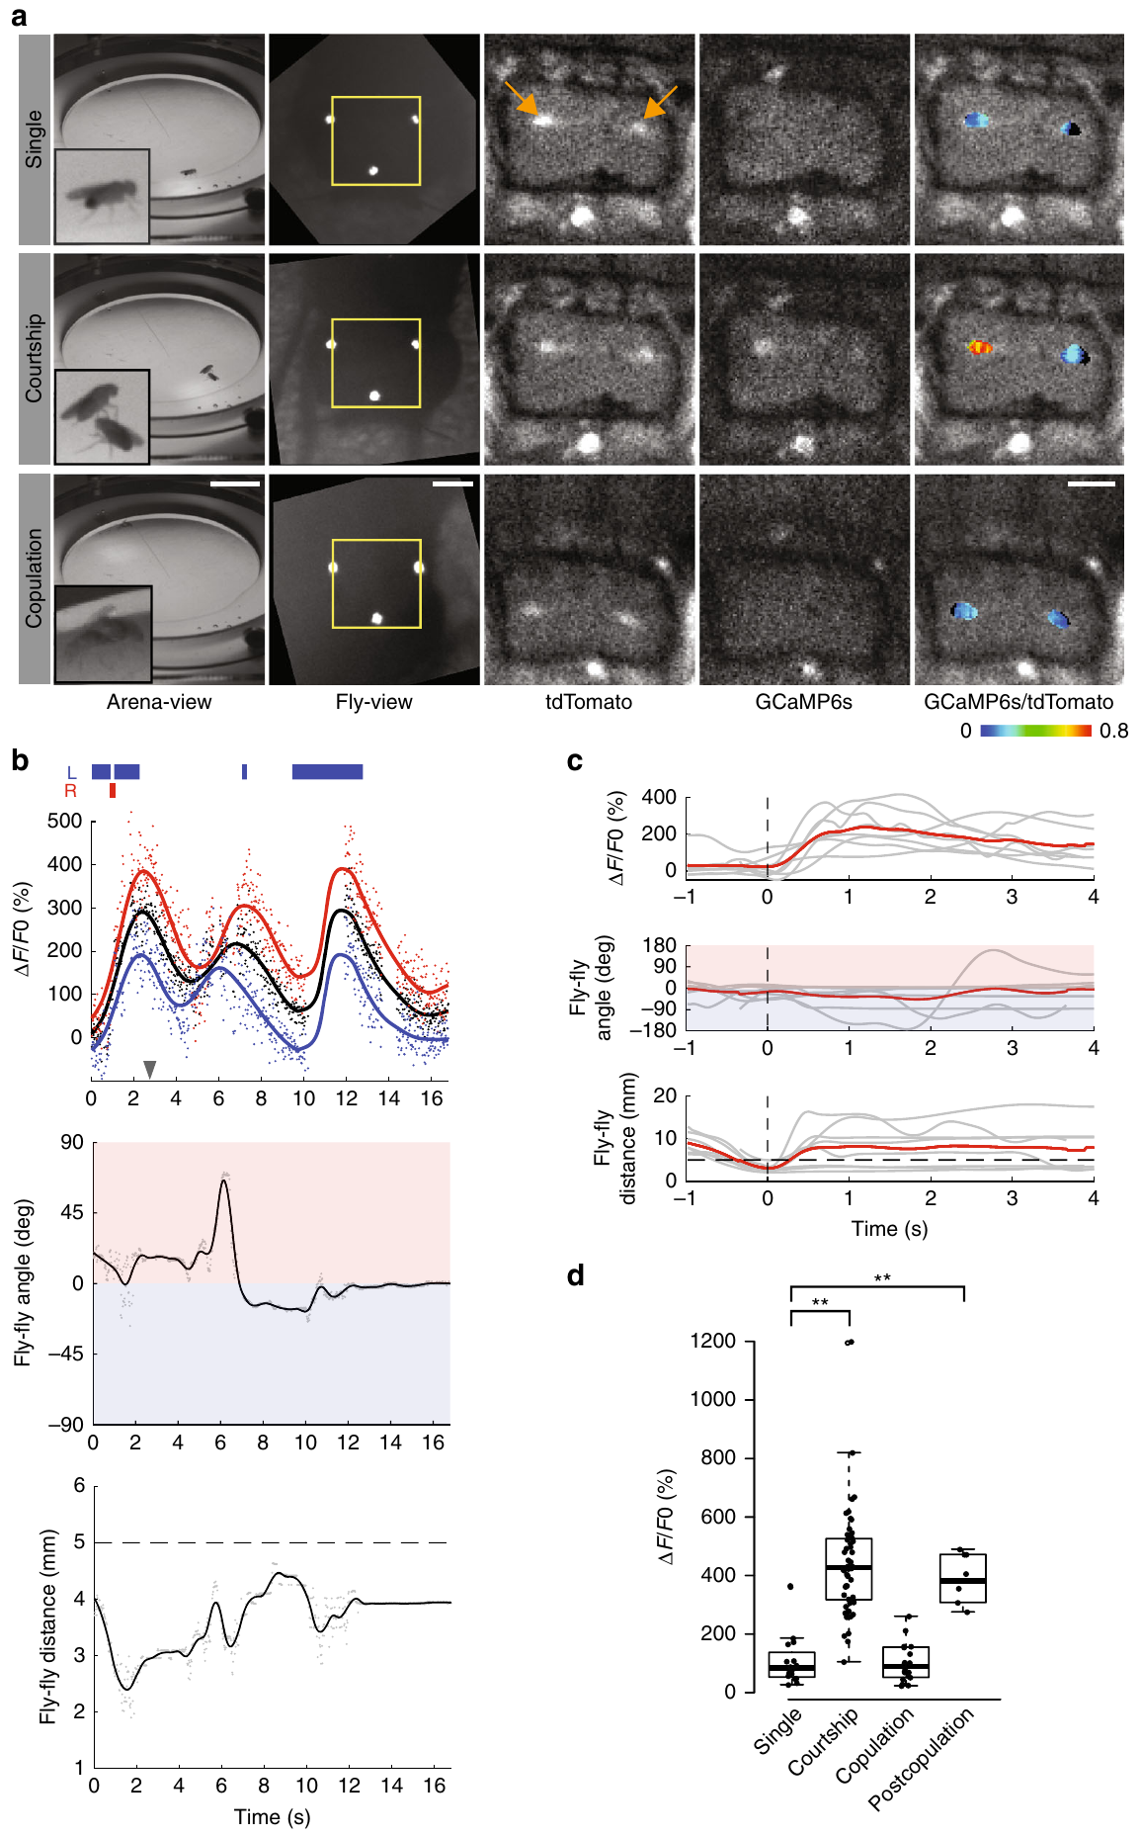
Two-color imaging constrains movement artifacts
A fluorescence change in a moving animal can come from activity, from altered focus or from a changing tissue orientation. Flyception2 measured calcium-dependent green GCaMP fluorescence together with calcium-independent red tdTomato fluorescence in the same targeted cells.
Both channels were recorded simultaneously at 50 Hz, with excitation at 473 and 561 nm. Taking the ratio reduced fluctuations shared by both channels. Frames were also screened for visible tracking beads, sharpness and excessive motion, and about 75% of frames in 100 s recordings passed these criteria.
These controls strengthen the attribution of fluorescence changes to cellular calcium. Rapid movements or occlusion can remove precisely timed parts of an interaction, so the analysis applies to the behavioral periods that pass the screen.
Grover et al. (2020), Fig. 2(a–d). P1 fluorescence and behavior during courtship and copulation.
Grover et al. (2020)
30
Notes:
• A fluorescence change in a moving animal may arise from activity, altered focus or changing tissue orientation. Flyception2 measured calcium-dependent green GCaMP fluorescence and calcium-independent red tdTomato fluorescence in the same targeted cells.
• The two channels were recorded simultaneously at 50 Hz using excitation at 473 and 561 nm. Their ratio reduced fluctuations shared by both channels. Frames were also filtered for visible tracking beads, sharpness and excessive motion; about 75% of frames in 100-s recordings passed those quality criteria.
– The calcium-independent signal measures changes that can affect both optical channels, such as tissue movement through the field of view. A ratio cannot correct every artifact if the channels respond differently or the tissue leaves focus. Recording exclusions therefore remain part of the biological interpretation, not simply a technical cleanup step.
• These controls improve the attribution of fluorescence changes to cellular calcium. They do not turn fluorescence into a direct spike recording or recover information from excluded frames. Interpretation remains conditional on the analyzed behavioral periods, because rapid movements or occlusion can remove precisely timed parts of an interaction.
References:
Dhruv Grover; Takeo Katsuki; Jinfang Li; Thomas J. Dawkins; Ralph J. Greenspan (2020). Imaging brain activity during complex social behaviors in Drosophila with Flyception2. Nature Communications 11(1): 623. https://doi.org/10.1038/s41467-020-14487-7
Figure: Grover et al. (2020), Fig. 2(a–d). P1 fluorescence and behavior during courtship and copulation.
Figure source: https://doi.org/10.1038/s41467-020-14487-7

Slide 40
Head tracking follows flies during copulation
Flyception2 tracks the head rather than the outline of the body, so the head stays identifiable when two flies overlap. Grover and colleagues built the system to record brain fluorescence in freely moving adult flies. The animal is untethered, with no cable running to the microscope.
Three glass retroreflective beads, each about 30 µm across, marked the imaging window. A tracking loop updated mirror position at 1,000 Hz, and focus followed changes in head height during courtship and copulation. Retroreflection returns incoming light toward its source, which makes the beads easy to track.
P1 fluorescence during the same social interaction was recorded in freely moving flies. The method keeps social contact in the measurement, which outline-based tracking had disrupted, and it still uses a surgically prepared window in a bounded arena. Recordings were made from the same targeted cells during courtship and mating.
Grover et al. (2020), Fig. 2(a–d). P1 fluorescence and behavior during courtship and copulation.
Grover et al. (2020)
30a
Notes:
• Head tracking follows flies during copulation.
• Explanation 1.
– Flyception2 tracks the head rather than the outline of the body, so the head stays identifiable when two flies overlap
– Grover and colleagues built the system to record brain fluorescence in freely moving adult flies. The animal is untethered, with no cable running to the microscope.
• Explanation 2.
– Three glass retroreflective beads, each about 30 µm across, marked the imaging window
– A tracking loop updated mirror position at 1,000 Hz, and focus followed changes in head height during courtship and copulation. Retroreflection returns incoming light toward its source, which makes the beads easy to track.
• Explanation 3.
– P1 fluorescence during the same social interaction was recorded in freely moving flies
– The method keeps social contact in the measurement, which outline-based tracking had disrupted, and it still uses a surgically prepared window in a bounded arena. Recordings were made from the same targeted cells during courtship and mating.
• Tracking.
– The system tracks the head instead of the body outline.
– The head stays identifiable when flies overlap.
• Hardware.
– Three glass beads, each about 30 µm across, marked the window.
– A tracking loop updated mirror position at 1,000 Hz.
• Focus.
– Focus followed changes in head height.
– Courtship and copulation were both tracked.
• Preparation.
– A surgically prepared window and a bounded arena were used.
– Social contact was preserved in the recording.
References:
Dhruv Grover; Takeo Katsuki; Jinfang Li; Thomas J. Dawkins; Ralph J. Greenspan (2020). Imaging brain activity during complex social behaviors in Drosophila with Flyception2. Nature Communications 11(1): 623. https://doi.org/10.1038/s41467-020-14487-7

Slide 41
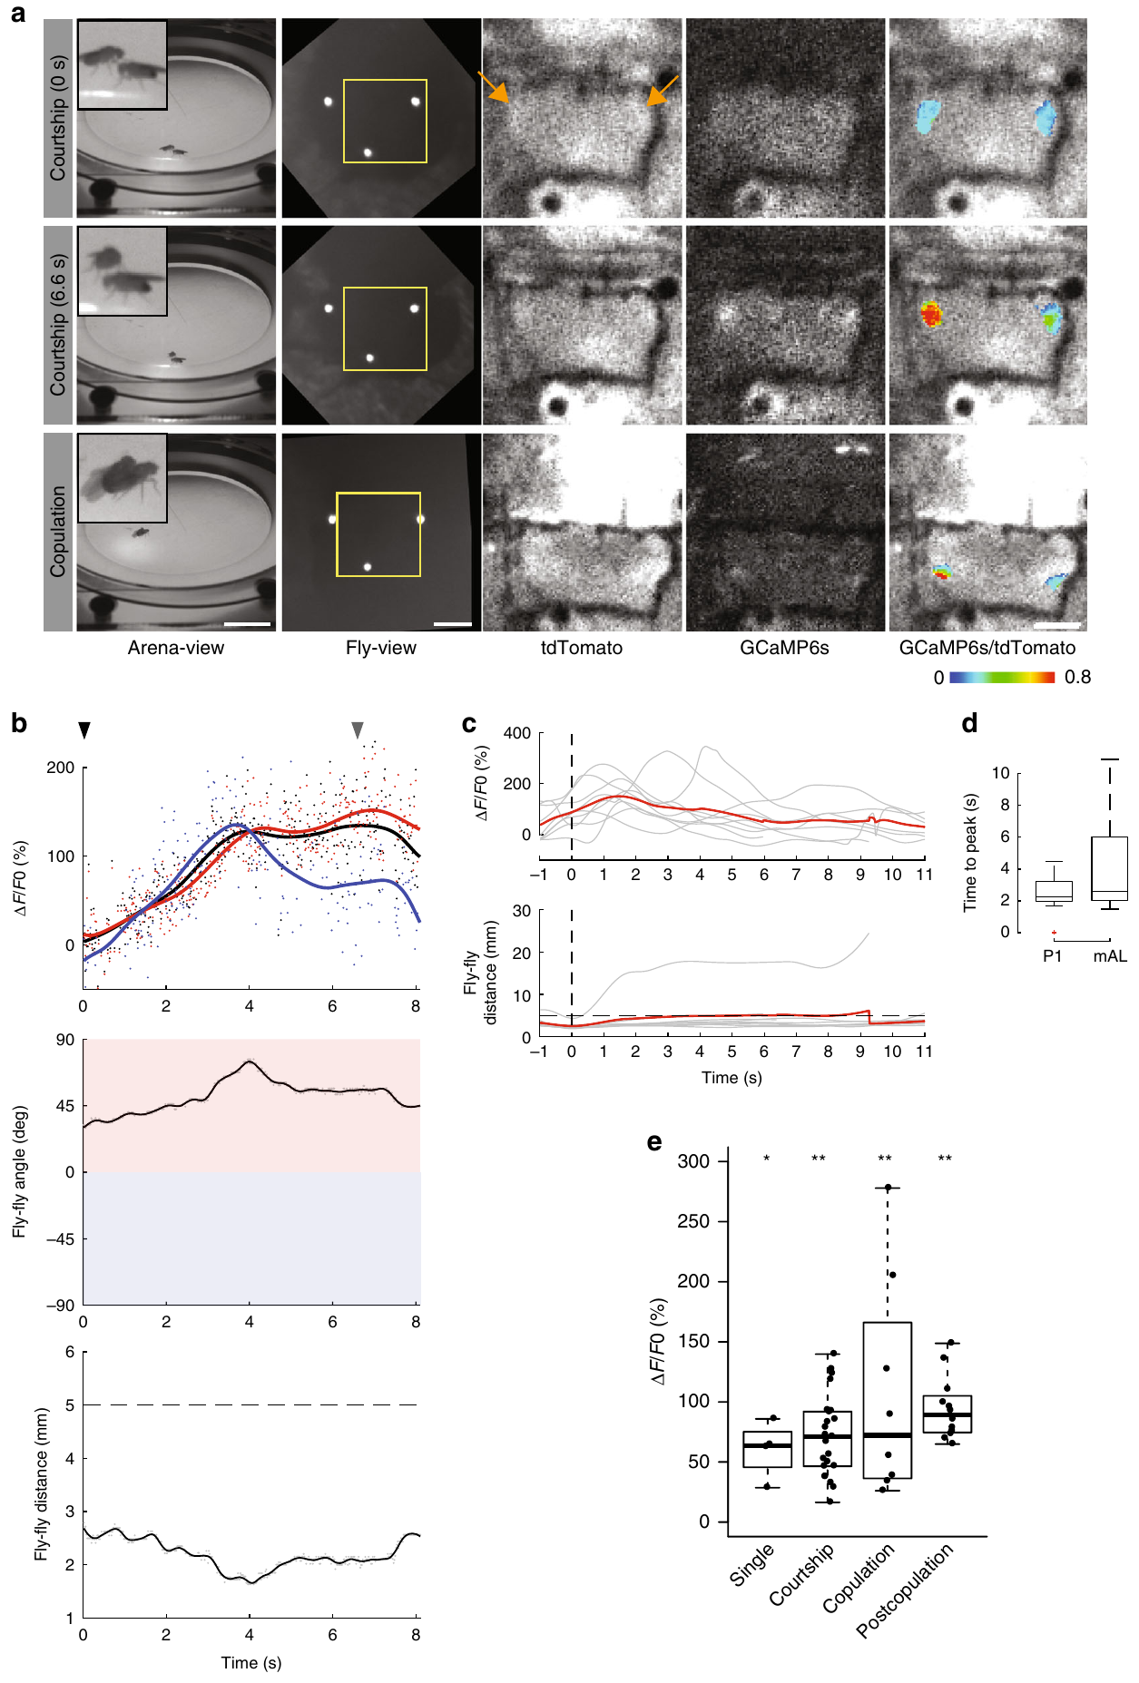
Courtship-related activity changes during copulation
P1 neurons were imaged by Grover and colleagues as a male moved toward, touched and mated with a female. Neural fluorescence was synchronized with the distance and angle between the two flies, which links activity to the ongoing social interaction.
P1 activity rose during courtship and fell during copulation, even though physical contact continued. After mating, P1 activity returned when the male again approached the female. In a separate targeted population, mAL neurons, which use GABA as their transmitter, stayed active across courtship and copulation.
GABA is a transmitter that can reduce the excitation of target cells. The contrasting activity patterns show that circuit recruitment depends on behavioral state, and recordings of this kind complement experiments that activate or remove particular neurons directly.
Grover et al. (2020), Fig. 2(a–d). P1 fluorescence and behavior during courtship and copulation.
Grover et al. (2020), Fig. 3(a–e). mAL-neuron fluorescence during courtship and mating.
Grover et al. (2020)
31
Notes:
• Grover and colleagues imaged identified P1 neurons while a male approached, contacted and copulated with a female. Neural fluorescence was synchronized with the distance and angle between the flies, providing a measured relation between activity and the ongoing social interaction.
• P1 activity increased during courtship but fell during copulation despite continuing physical contact. After mating, P1 activity could return when the male again approached the female. In a separate targeted population, mAL neurons, cells using γ-aminobutyric acid (GABA), a transmitter that can reduce target-cell excitation, remained active across courtship and copulation.
– The same neuron population can respond differently to contact depending on the behavioral state of the animal. Comparing identified populations prevents all activity during mating from being assigned a common sign or function. GABAergic identity supplies a candidate inhibitory role, but the observed calcium association does not specify which receptor on P1 mediates a particular state change.
• The contrasting activity patterns support behavioral-state-dependent circuit recruitment. They do not establish the causal receptor mechanism of the P1 decrease or prove that mAL activity alone causes it. These recordings complement, rather than replace, experiments directly activating or removing particular neurons.
References:
Dhruv Grover; Takeo Katsuki; Jinfang Li; Thomas J. Dawkins; Ralph J. Greenspan (2020). Imaging brain activity during complex social behaviors in Drosophila with Flyception2. Nature Communications 11(1): 623. https://doi.org/10.1038/s41467-020-14487-7
Figure: Grover et al. (2020), Fig. 2(a–d). P1 fluorescence and behavior during courtship and copulation.
Figure source: https://doi.org/10.1038/s41467-020-14487-7
Figure: Grover et al. (2020), Fig. 3(a–e). mAL-neuron fluorescence during courtship and mating.
Figure source: https://doi.org/10.1038/s41467-020-14487-7

Slide 42
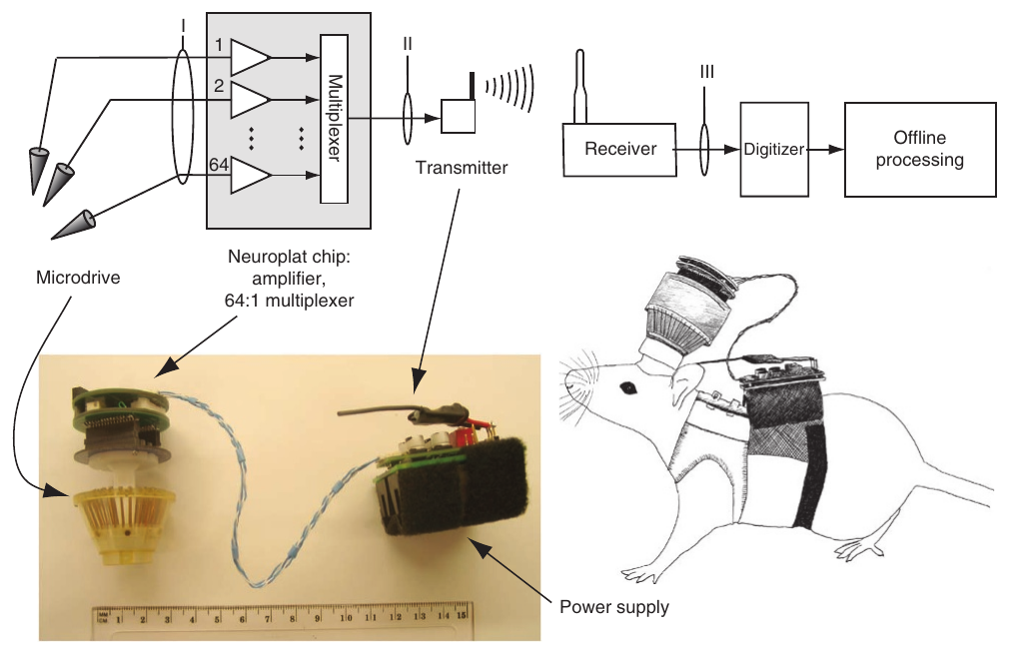
Wireless telemetry removes the external recording tether
Neural telemetry transmits recorded electrical signals remotely. Szuts and colleagues built a rat-borne system that combines implanted electrodes, a head-mounted amplifier and a radio transmitter carried in a back harness. A short connection links the animal's own boards, and no cable runs to the recording computer.
The electronics processed up to 64 channels, each sampled at 20 kHz, and sent the combined signal to a receiver. Continuous operation lasted about 6 h with the larger battery configuration. The arrangement made recordings possible during outdoor movement and during travel through tunnels.
Wireless access expands the movements and environments available to an experiment, while implant surgery and the carried mass are part of the preparation. The validation covered rats carrying this particular payload and the larger battery.
Szuts et al. (2011), Fig. 1. Published wireless headstage, harness and recording components.
Szuts et al. (2011)
32
Notes:
• Neural telemetry transmits recorded electrical signals remotely. Szuts and colleagues built a rat-borne system combining implanted electrodes, a head-mounted amplifier and a radio transmitter carried in a back harness. A short connection remained between the animal’s own boards, but no cable linked the rat to the recording computer.
• The electronics could process up to 64 channels sampled at 20 kHz each and send the combined signal to a receiver. Continuous operation lasted approximately 6 h with the larger battery configuration. The arrangement enabled recordings during outdoor movement and travel through tunnels.
– An electrode channel measures voltage relative to a reference, not the membrane potential of an isolated identified cell. Amplification makes small signals large enough for transmission and analysis. The headstage and harness are attached to the animal, so removing the external tether changes the mechanics of the experiment without making the apparatus weightless.
• Wireless access expands the available movements and environments, but does not remove implant surgery or carried mass. The study validated recordings in rats with this particular payload. Its engineering success cannot be assumed for a small insect or for another animal whose movement is differently constrained by the device.
References:
Tobi A Szuts; Vitaliy Fadeyev; Sergei Kachiguine; Alexander Sher; Matthew V Grivich; Margarida Agrochão; Pawel Hottowy; Wladyslaw Dabrowski; Evgueniy V Lubenov; Athanassios G Siapas; Naoshige Uchida; Alan M Litke; Markus Meister (2011). A wireless multi-channel neural amplifier for freely moving animals. Nature Neuroscience 14(2): 263-269. https://doi.org/10.1038/nn.2730
Figure: Szuts et al. (2011), Fig. 1. Published wireless headstage, harness and recording components.
Figure source: https://doi.org/10.1038/nn.2730

Slide 43
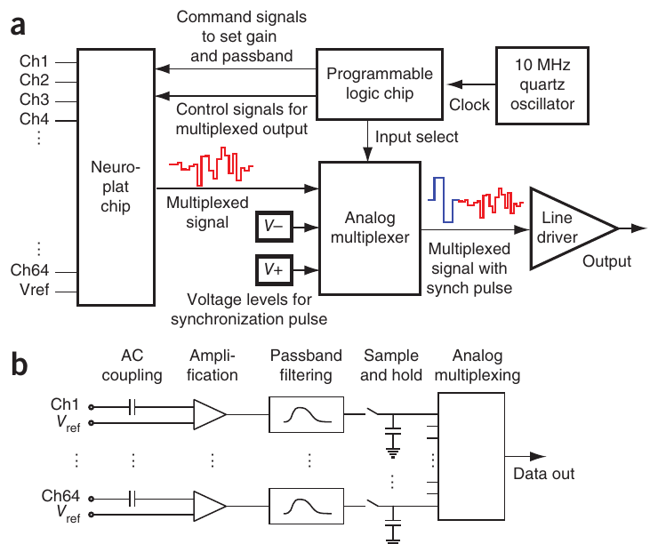
Sampling and bandwidth define the observable signal
Sampling rate specifies how often a signal is measured, whereas bandwidth specifies the range of frequencies the system retains. In the configuration of Szuts and colleagues, electrode voltages passed through a filter between 80 and 2,300 Hz, and each channel was sampled 20,000 times per second.
A simultaneous sample-and-hold stage captured the channel voltages before time-division multiplexing placed successive channels onto a shared output. Synchronization markers identified each channel scan, so the original signals could be rebuilt after radio transmission.
Frequency components removed by the filter stay absent however fast the sampling is. The configuration suited extracellular spike analysis, so hardware settings determine which neural events a behavioral experiment can relate to movement, sensation or task timing.
Szuts et al. (2011), Fig. 2(a–b). Sampling, multiplexing and signal conditioning in the original device.
Szuts et al. (2011)
33
Notes:
• Sampling rate specifies how often a signal is measured, whereas bandwidth specifies the range of frequencies retained by the system. Szuts and colleagues filtered electrode voltages from 80 to 2,300 Hz and sampled each channel at 20 kHz in their recording configuration.
• A simultaneous sample-and-hold stage captured the channel voltages before time-division multiplexing, placing successive channels onto a shared output. Synchronization markers identified each channel scan so that the original signals could be reconstructed after radio transmission.
– A sample-and-hold circuit captures a value at a specified instant and retains it while that channel is read out. Shared timing reduces ambiguity about whether a difference between channels arose from the circuit or from different acquisition times. The original paper’s circuit panel documents the implemented device, rather than a newly drawn teaching model.
• High sampling rate does not restore frequency components removed by the filter. The configuration was suitable for extracellular spike analysis, but did not preserve the complete low-frequency signal as measured by other systems. Hardware settings therefore determine which neural events a behavioral experiment can meaningfully relate to movement, sensation or task timing.
References:
Tobi A Szuts; Vitaliy Fadeyev; Sergei Kachiguine; Alexander Sher; Matthew V Grivich; Margarida Agrochão; Pawel Hottowy; Wladyslaw Dabrowski; Evgueniy V Lubenov; Athanassios G Siapas; Naoshige Uchida; Alan M Litke; Markus Meister (2011). A wireless multi-channel neural amplifier for freely moving animals. Nature Neuroscience 14(2): 263-269. https://doi.org/10.1038/nn.2730
Figure: Szuts et al. (2011), Fig. 2(a–b). Sampling, multiplexing and signal conditioning in the original device.
Figure source: https://doi.org/10.1038/nn.2730

Slide 44
Filters set which spikes can be measured
In the Szuts design, electrode voltages passed a filter between 80 and 2,300 Hz, and each channel was sampled 20,000 times per second. Sampling rate states how often a signal is measured, while bandwidth states which frequency range the filter keeps. Both settings determine what the recording can show.
A simultaneous sample-and-hold stage captured the channel voltages before time-division multiplexing placed successive channels onto one shared output. Synchronization markers identified each channel scan, so the original signals could be rebuilt after radio transmission. Multiplexing therefore sends the channels in turn through one radio link.
Frequency components removed by the filter stay absent however fast the sampling is. The configuration suited extracellular spike analysis, so hardware settings decide which neural events a behavioral experiment can relate to movement, sensation or task timing.
Szuts et al. (2011), Fig. 2(a–b). Sampling, multiplexing and signal conditioning in the original device.
Szuts et al. (2011)
33a
Notes:
• Filters set which spikes can be measured.
• Explanation 1.
– In the Szuts design, electrode voltages passed a filter between 80 and 2,300 Hz, and each channel was sampled 20,000 times per second
– Sampling rate states how often a signal is measured, while bandwidth states which frequency range the filter keeps. Both settings determine what the recording can show.
• Explanation 2.
– A simultaneous sample-and-hold stage captured the channel voltages before time-division multiplexing placed successive channels onto one shared output
– Synchronization markers identified each channel scan, so the original signals could be rebuilt after radio transmission. Multiplexing therefore sends the channels in turn through one radio link.
• Explanation 3.
– Frequency components removed by the filter stay absent however fast the sampling is
– The configuration suited extracellular spike analysis, so hardware settings decide which neural events a behavioral experiment can relate to movement, sensation or task timing.
• Settings.
– Electrode voltages were filtered from 80 to 2,300 Hz.
– Each channel was sampled at 20 kHz.
• Multiplexing.
– A sample-and-hold stage captured the channel voltages.
– Successive channels were placed onto one shared output.
• Markers.
– Synchronization markers identified each channel scan.
– The original signals could be rebuilt after radio transmission.
• Meaning.
– Hardware settings define which events are measurable.
– Spike analysis was the configuration's main purpose.
References:
Tobi A Szuts; Vitaliy Fadeyev; Sergei Kachiguine; Alexander Sher; Matthew V Grivich; Margarida Agrochão; Pawel Hottowy; Wladyslaw Dabrowski; Evgueniy V Lubenov; Athanassios G Siapas; Naoshige Uchida; Alan M Litke; Markus Meister (2011). A wireless multi-channel neural amplifier for freely moving animals. Nature Neuroscience 14(2): 263-269. https://doi.org/10.1038/nn.2730

Slide 45
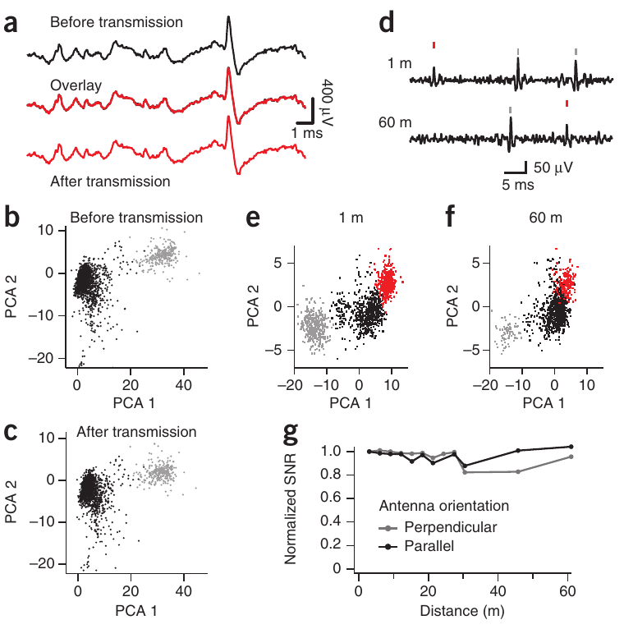
Transmission quality is tested against a wired signal
Wireless recordings need validation of signal fidelity as well as transmission range. Szuts and colleagues compared the same extracellular waveform before and after radio transmission, then tested whether the reconstructed recordings kept distinguishable spike shapes.
The system added less than 4 µV of electrode-referred noise. In line-of-sight tests, recordings at distances up to 60 m kept their spike waveforms and separable waveform clusters. Antenna orientation and a known test signal characterized how signal quality changed with distance.
A sorted unit is a putative neuron recognized as one group of similar extracellular waveforms. Retained clustering supports the reliability of this recording chain, so a sorted unit can be linked to a stable waveform cluster even after the signal has traveled by radio.
Szuts et al. (2011), Fig. 4(a–g). Spike waveforms and unit separation before and after wireless transmission.
Szuts et al. (2011)
34
Notes:
• Wireless recordings require validation of signal fidelity as well as transmission range. Szuts and colleagues compared the same extracellular waveform before and after radio transmission, then tested whether the reconstructed recordings retained distinguishable spike shapes.
• The system introduced less than 4 µV of electrode-referred noise. In line-of-sight tests, recordings at distances up to 60 m retained spike waveforms and separable waveform clusters. Antenna orientation and a known test signal were used to characterize distance-dependent signal quality.
– Electrode-referred noise expresses added uncertainty as an equivalent voltage at the electrode input. Comparing a signal with itself before and after transmission isolates the engineering change more directly than comparing two unrelated behavioral recordings. A stable waveform cluster supports unit separation while leaving its anatomical and molecular identity unresolved.
• A sorted unit is a putative neuron identified from a cluster of similar extracellular waveforms. Retained clustering supports the reliability of this recording chain, but does not establish a neuron’s transmitter or causal behavioral role. Differences in firing rate between separate distance recordings also cannot be assigned to transmission when behavioral state was uncontrolled.
References:
Tobi A Szuts; Vitaliy Fadeyev; Sergei Kachiguine; Alexander Sher; Matthew V Grivich; Margarida Agrochão; Pawel Hottowy; Wladyslaw Dabrowski; Evgueniy V Lubenov; Athanassios G Siapas; Naoshige Uchida; Alan M Litke; Markus Meister (2011). A wireless multi-channel neural amplifier for freely moving animals. Nature Neuroscience 14(2): 263-269. https://doi.org/10.1038/nn.2730
Figure: Szuts et al. (2011), Fig. 4(a–g). Spike waveforms and unit separation before and after wireless transmission.
Figure source: https://doi.org/10.1038/nn.2730

Slide 46
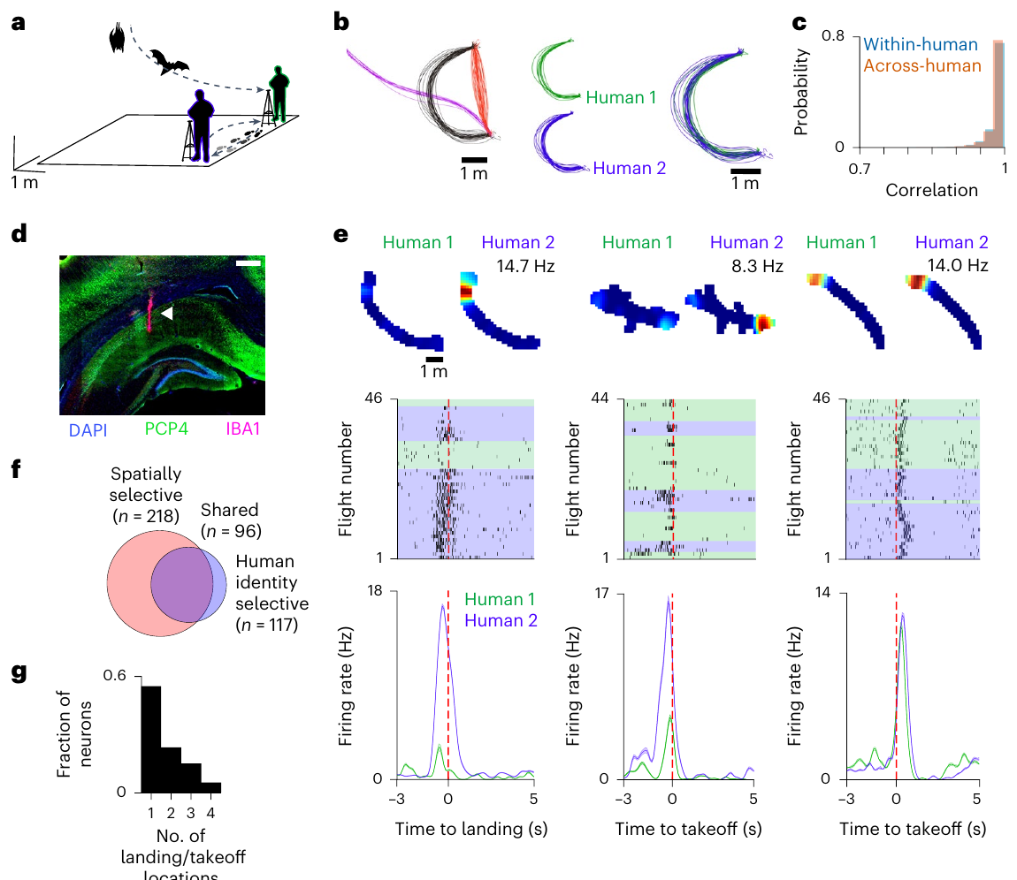
Wireless recordings retain three-dimensional flight
While Egyptian fruit bats flew between reward sites, Snyder and colleagues recorded from the hippocampus, a region that participates in spatial representation. A light implanted microdrive placed electrodes in dorsal CA1, a hippocampal subregion that histology confirmed after recording.
Bats spontaneously followed reproducible three-dimensional paths to human experimenters who offered fruit. The humans exchanged reward locations every 5 min while keeping their hands on fixed platforms. Wireless recording retained the bats' flights between sites without an external recording tether.
Repeated paths let neural activity be compared during similar movement toward different experimenters. That control removes one source of behavioral variability while the bats still choose their own flights. The flights were self-initiated, so each bat chose when to travel between sites.
Snyder et al. (2024), Fig. 1(a–g). Flight trajectories, hippocampal histology and experimenter-dependent firing.
Snyder et al. (2024)
35
Notes:
• Snyder and colleagues recorded the hippocampus, a brain region involved in spatial representation, while Egyptian fruit bats flew between reward locations. A lightweight implanted microdrive positioned electrodes in dorsal CA1, a hippocampal subdivision identified by post-recording histology.
• Bats spontaneously followed reproducible three-dimensional paths to human experimenters offering fruit. The humans exchanged reward locations every 5 min while their hands remained on fixed platforms. Wireless recording retained flight between sites without an external recording tether.
– A microdrive adjusts electrode depth in small steps rather than moving the entire animal or recording apparatus. Histology checks whether the sampled tissue matches the intended brain region. Consistent flight trajectories make it possible to ask whether a change in firing reflects more than a change in the bat’s path.
• Repeated paths allowed neural activity to be compared during similar movement toward different experimenters. This controls one source of behavioral variability while preserving self-initiated flight. The reward task still occurred in a prepared laboratory room and included human participants; it should not be described as neural recording during unrestricted wild navigation.
References:
Madeleine C. Snyder; Kevin K. Qi; Michael M. Yartsev (2024). Neural representation of human experimenters in the bat hippocampus. Nature Neuroscience 27(9): 1675-1679. https://doi.org/10.1038/s41593-024-01690-8
Figure: Snyder et al. (2024), Fig. 1(a–g). Flight trajectories, hippocampal histology and experimenter-dependent firing.
Figure source: https://doi.org/10.1038/s41593-024-01690-8

Slide 47
Neural and positional clocks require synchronization
A shared time reference is needed before a recorded spike can be matched to an external event. Both bats and human experimenters carried tags, and a real-time location system estimated those positions from fixed room anchors, as Snyder and colleagues describe.
An external timing signal kept the position samples, taken at 100 Hz, aligned with the neural data. Repeated trajectories were aligned to landing or take-off, so neuronal discharge could be compared at matching stages of flights toward different reward providers.
A landing-aligned firing change can be distinguished from firing linked to a different location or route when the spatial and temporal measurements are precise enough. Synchronization fixes which measured position corresponds to each recorded spike.
Snyder et al. (2024), Fig. 1(a–g). Flight trajectories, hippocampal histology and experimenter-dependent firing.
Snyder et al. (2024)
36
Notes:
• Relating a recorded spike to an external event requires a shared time reference. Snyder and colleagues tracked both bats and human experimenters with a real-time location system, which estimates the positions of attached tags using fixed room anchors.
• Positions were sampled at 100 Hz and synchronized to the neural recordings with an external timing signal. Repeated trajectories were aligned to landing or take-off, allowing comparisons of neuronal discharge at corresponding stages of flights toward different reward providers.
– Time stamps from two independently running instruments can drift even if both report measurements in seconds. A shared synchronization event relates their clocks. The experiment also recorded the humans’ positions, because an external participant can move while the bat’s own trajectory remains similar.
• A landing-aligned firing change can be distinguished from firing associated with a different location or route only when spatial and temporal measurements are sufficiently precise. Synchronization establishes the correspondence between measurements; it does not establish that an observed spike caused landing or that a landing event caused the spike through one identified synaptic pathway.
References:
Madeleine C. Snyder; Kevin K. Qi; Michael M. Yartsev (2024). Neural representation of human experimenters in the bat hippocampus. Nature Neuroscience 27(9): 1675-1679. https://doi.org/10.1038/s41593-024-01690-8
Figure: Snyder et al. (2024), Fig. 1(a–g). Flight trajectories, hippocampal histology and experimenter-dependent firing.
Figure source: https://doi.org/10.1038/s41593-024-01690-8

Slide 48
Synchronized clocks link spikes to landings
Snyder and colleagues tracked bats and human experimenters with a real-time location system that estimates tag positions from fixed room anchors. Relating a spike to a landing requires that the positional and neural clocks share one reference.
Positions were sampled at 100 Hz and synchronized to the neural data through an external timing signal. Repeated trajectories were aligned to landing or take-off, so discharge could be compared at matching flight stages toward different reward providers. Each aligned trajectory therefore lines up with the same event in every flight.
A landing-aligned change in firing can be distinguished from firing linked to a different location or route when the spatial and temporal measurements are precise enough. Synchronization fixes which measured position corresponds to each recorded spike. Matched timing keeps each flight's events aligned across trials.
Snyder et al. (2024), Fig. 1(a–g). Flight trajectories, hippocampal histology and experimenter-dependent firing.
Snyder et al. (2024)
36a
Notes:
• Synchronized clocks link spikes to landings.
• Explanation 1.
– Snyder and colleagues tracked bats and human experimenters with a real-time location system that estimates tag positions from fixed room anchors
– Relating a spike to a landing requires that the positional and neural clocks share one reference.
• Explanation 2.
– Positions were sampled at 100 Hz and synchronized to the neural data through an external timing signal
– Repeated trajectories were aligned to landing or take-off, so discharge could be compared at matching flight stages toward different reward providers. Each aligned trajectory therefore lines up with the same event in every flight.
• Explanation 3.
– A landing-aligned change in firing can be distinguished from firing linked to a different location or route when the spatial and temporal measurements are precise enough
– Synchronization fixes which measured position corresponds to each recorded spike. Matched timing keeps each flight's events aligned across trials.
• Tracking.
– A real-time location system estimated tag positions from room anchors.
– Bats and human experimenters were both tracked.
• Sampling.
– Positions were sampled at 100 Hz.
– An external timing signal synchronized them with the neural data.
• Alignment.
– Repeated trajectories were aligned to landing or take-off.
– Discharge was compared across matching flight stages.
• Precision.
– The spatial and temporal measurements set the resolution.
– Synchronization matches each spike to a measured position.
References:
Madeleine C. Snyder; Kevin K. Qi; Michael M. Yartsev (2024). Neural representation of human experimenters in the bat hippocampus. Nature Neuroscience 27(9): 1675-1679. https://doi.org/10.1038/s41593-024-01690-8

Slide 49
Experimenter identity modulates hippocampal firing
Hippocampal firing was compared by Snyder and colleagues across flights on closely matched paths toward two human experimenters. Exchanging the reward locations decoupled the identity of the reward provider from any one fixed reward site, and stable flight trajectories kept self-motion differences small.
About 48% of the analyzable neurons differed in discharge according to the experimenter at the landing site. A subset of cells showed both spatial selectivity and modulation tied to the experimenter. The effect often appeared at one particular take-off or landing location rather than uniformly across every site.
The result supports a neural representation that combines the animal's position with features associated with an external individual. Hippocampal responses therefore carry information about another individual in addition to the animal's own location.
Snyder et al. (2024), Fig. 1(a–g). Flight trajectories, hippocampal histology and experimenter-dependent firing.
Snyder et al. (2024)
37
Notes:
• Snyder and colleagues compared hippocampal firing during flights along closely matched paths toward two different human experimenters. Location exchange separated the identity of the reward provider from one fixed reward site, while stable flight trajectories constrained self-motion differences.
• Nearly half of the analyzable neurons, approximately 48%, differed in their discharge according to the experimenter at the landing site. Some cells combined spatial selectivity with experimenter-related modulation. The effect often occurred at one particular take-off or landing location rather than uniformly across every site.
– Spatial selectivity means that a neuron’s firing depends on where the animal is. Experimenter-related selectivity is an additional measured dependency, not evidence that the spatial information disappears. Exchanging locations reduces the confound between who delivers a reward and where that reward is delivered.
• The result supports a neural representation combining the animal’s position with features associated with an external individual. It does not identify the sensory cue carrying that information or prove recognition of human identity independently of every visual, olfactory and learned reward-associated feature.
References:
Madeleine C. Snyder; Kevin K. Qi; Michael M. Yartsev (2024). Neural representation of human experimenters in the bat hippocampus. Nature Neuroscience 27(9): 1675-1679. https://doi.org/10.1038/s41593-024-01690-8
Figure: Snyder et al. (2024), Fig. 1(a–g). Flight trajectories, hippocampal histology and experimenter-dependent firing.
Figure source: https://doi.org/10.1038/s41593-024-01690-8

Slide 50
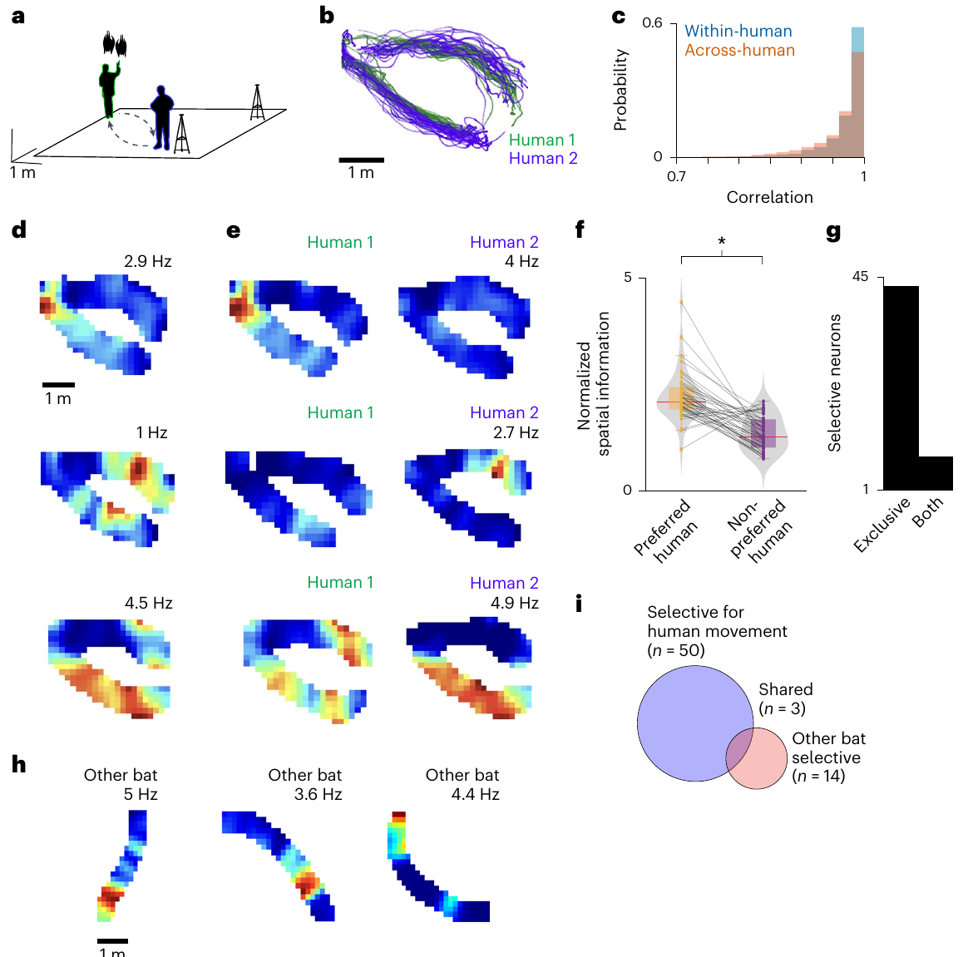
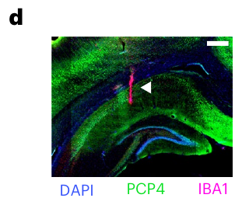
Matched behavior constrains experimenter-related coding
An experimenter-related response could arise indirectly from changes in the animal's movement, its reward or a nearby animal. Analyses were confined to comparable trajectories, and flights with another member of the same species at take-off or landing were removed.
Experimenter-dependent firing persisted in more than 40% of the analyzable units after that exclusion. In separate trials, a resting bat stayed at a stable position while humans repeated fixed paths, and about 20% of analyzable units carried information about human position.
These comparisons argue against explanations based solely on the bat's own movement or on a nearby bat. They keep the external participant's influence in the measurement, and they tie that influence to observed neural coding under controlled behavioral comparisons.
Snyder et al. (2024), Fig. 1(d). Recorded dorsal hippocampus with electrode tracks and a 500-µm scale bar.
Snyder et al. (2024), Fig. 2(a–h). Human traverses and hippocampal responses in resting bats.
Snyder et al. (2024)
38
Notes:
• An experimenter-related response could arise indirectly from changes in the animal’s movement, reward or another animal nearby. Snyder and colleagues restricted analyses to comparable trajectories and also excluded flights with a conspecific at take-off or landing. A conspecific is another individual of the same species.
• Experimenter-dependent firing persisted in over 40% of the analyzable units after that exclusion. During separate trials, a resting bat remained at a stable position while humans repeated fixed paths; about 20% of analyzable units carried information about human position.
– A stationary animal provides a different comparison from a moving animal on a matched path. Activity changing while the bat remains still can be related to external movement rather than the bat’s own locomotion. The experiment does not selectively remove vision, hearing or olfaction, so their relative contributions remain unresolved.
• These comparisons weaken explanations based solely on the bat’s own movement or a nearby bat. They retain a measured influence of the external participant without identifying one sensory modality or receptor. The evidence remains observational neural coding with controlled behavioral comparisons, rather than a neural intervention establishing necessity for social behavior.
References:
Madeleine C. Snyder; Kevin K. Qi; Michael M. Yartsev (2024). Neural representation of human experimenters in the bat hippocampus. Nature Neuroscience 27(9): 1675-1679. https://doi.org/10.1038/s41593-024-01690-8
Figure: Snyder et al. (2024), Fig. 2(a–h). Human traverses and hippocampal responses in resting bats.
Figure source: https://doi.org/10.1038/s41593-024-01690-8
Figure: Snyder et al. (2024), Fig. 1(d). Recorded dorsal hippocampus with electrode tracks and a 500-µm scale bar.
Figure source: https://doi.org/10.1038/s41593-024-01690-8

Slide 51
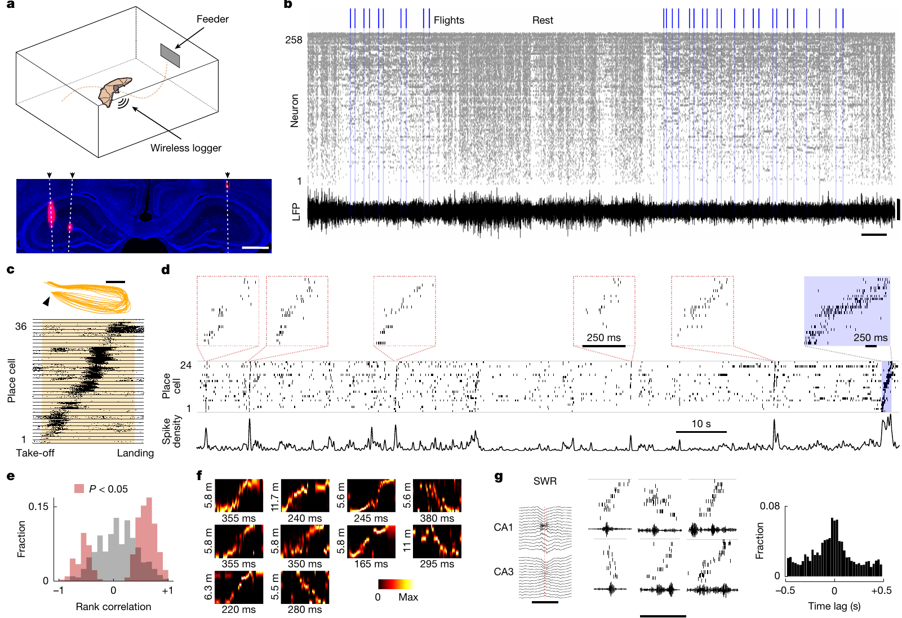
Large ensembles can be recorded during aerial foraging
A neural ensemble is a group of neurons whose joint activity can carry information. Wireless Neuropixels recordings from the dorsal hippocampus were made by Forli and colleagues in freely flying Egyptian fruit bats that foraged for rewards at their own pace.
The system recorded single-unit activity together with local field potentials, which reflect nearby population currents. Flights alternated spontaneously with rest. Of the flight-active neurons, about 71% satisfied the study's test for spatial selectivity along the sampled routes.
Population recording reveals activity sequences that one electrode or one cell would miss. Freely chosen flights combined with repeated routes keep natural variability while still allowing consistent measurement. Sequences can be compared across repeated flights.
Forli et al. (2025), Fig. 1(a–j). Wireless Neuropixels recordings and flight-sequence replay.
Forli et al. (2025)
39
Notes:
• A neural ensemble is a population of neurons whose combined activity can represent information. Forli and colleagues used wireless Neuropixels recordings from the dorsal hippocampus of freely flying Egyptian fruit bats engaged in self-paced, rewarded aerial foraging.
• The system recorded single-unit activity together with local field potentials, extracellular signals reflecting nearby population currents. Flights alternated spontaneously with rest. About 71% of flight-active neurons met the study’s criterion for spatial selectivity across the sampled trajectories.
– Neuropixels probes provide many closely spaced recording sites, allowing simultaneous sampling from a large neuronal population. A local field potential differs from a sorted unit because it combines activity across sources rather than isolating one waveform cluster. The two measurements describe related but distinct levels of circuit activity.
• Population recording allows comparisons of activity sequences that one electrode or one cell cannot provide. The combination of freely chosen flights and repeated routes preserves variability while enabling consistent measurement. It does not remove the laboratory’s reward structure, and spatially selective discharge alone does not establish that those cells are required for choosing a route.
References:
Angelo Forli; Wudi Fan; Kevin K. Qi; Michael M. Yartsev (2025). Replay and representation dynamics in the hippocampus of freely flying bats. Nature 645(8082): 974-980. https://doi.org/10.1038/s41586-025-09341-z
Figure: Forli et al. (2025), Fig. 1(a–j). Wireless Neuropixels recordings and flight-sequence replay.
Figure source: https://doi.org/10.1038/s41586-025-09341-z

Slide 52
Ensembles record freely flying foraging bats
A neural ensemble is a group of neurons whose joint activity can carry information. Wireless Neuropixels recordings from the dorsal hippocampus were made by Forli and colleagues in freely flying Egyptian fruit bats. The bats chose when to fly and foraged for rewards at their own pace.
The system recorded single-unit activity together with local field potentials, which reflect nearby population currents. Flights alternated spontaneously with rest, and about 71% of flight-active neurons showed spatial selectivity across the sampled trajectories. Both single units and population signals were therefore available for each flight.
Population recording reveals activity sequences that one electrode or one cell would miss. Freely chosen flights combined with repeated routes keep natural variability while still allowing consistent measurement. Sequences can be compared across repeated flights, which is the value of the design.
Forli et al. (2025), Fig. 1(a–j). Wireless Neuropixels recordings and flight-sequence replay.
Forli et al. (2025)
39a
Notes:
• Ensembles record freely flying foraging bats.
• Explanation 1.
– A neural ensemble is a group of neurons whose joint activity can carry information
– Wireless Neuropixels recordings from the dorsal hippocampus were made by Forli and colleagues in freely flying Egyptian fruit bats. The bats chose when to fly and foraged for rewards at their own pace.
• Explanation 2.
– The system recorded single-unit activity together with local field potentials, which reflect nearby population currents
– Flights alternated spontaneously with rest, and about 71% of flight-active neurons showed spatial selectivity across the sampled trajectories. Both single units and population signals were therefore available for each flight.
• Explanation 3.
– Population recording reveals activity sequences that one electrode or one cell would miss
– Freely chosen flights combined with repeated routes keep natural variability while still allowing consistent measurement. Sequences can be compared across repeated flights, which is the value of the design.
• Preparation.
– Wireless Neuropixels recorded the dorsal hippocampus.
– The bats flew freely and foraged at a self-paced rate.
• Signals.
– Single-unit activity and local field potentials were recorded together.
– Field potentials reflect nearby population currents.
• Selectivity.
– About 71% of flight-active neurons showed spatial selectivity.
– The trajectories were sampled across the flights.
• Meaning.
– Population recordings expose sequences that single cells cannot show.
– Repeated routes keep variability while enabling consistent measurement.
References:
Angelo Forli; Wudi Fan; Kevin K. Qi; Michael M. Yartsev (2025). Replay and representation dynamics in the hippocampus of freely flying bats. Nature 645(8082): 974-980. https://doi.org/10.1038/s41586-025-09341-z

Slide 53
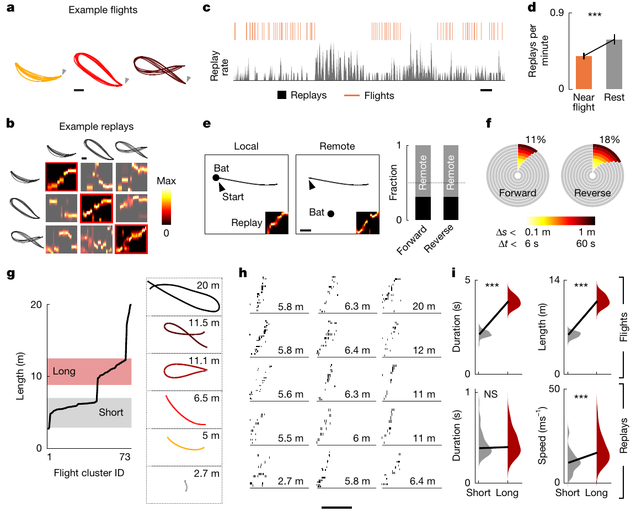
Rest events replay compressed flight sequences
Replay means that an ordered neuronal sequence tied to an earlier path is reactivated. Forli and colleagues compared hippocampal place-cell activity during flight with brief population events that occurred while the bats rested. Place cells are neurons whose discharge depends on position. Their firing marks where the animal is along a route.
Detected replay events had a median duration near 358 ms and could preserve either the forward or the reverse order of flight-related activity. They coincided with sharp-wave ripples, brief coordinated field-potential events, and often represented paths remote from the bat's current resting location. Each event reflects an organized sequence.
Sequence comparisons and position decoding show structured reactivation rather than indiscriminate population firing. Because the reactivated paths can lie far from the resting spot, the rest-time events carry route information about places other than where the bat currently sits.
Snyder et al. (2024), Fig. 1(d). Recorded dorsal hippocampus with electrode tracks and a 500-µm scale bar.
Forli et al. (2025), Fig. 2(a–i). Replay location, timing and scaling across flight trajectories.
Forli et al. (2025); Snyder et al. (2024)
40
Notes:
• Replay is the reactivation of an ordered neuronal sequence related to an earlier behavioral trajectory. Forli and colleagues compared hippocampal place-cell activity during flight with brief population events occurring while the bats rested. Place cells are neurons with position-dependent discharge.
• Detected replay events had a median duration near 358 ms and could preserve either the forward or reverse ordering of flight-related activity. They coincided with sharp-wave ripples, brief coordinated field-potential events, and frequently represented paths remote from the bat’s current resting location.
– Decoding estimates represented position from the firing of neurons with known spatial tuning. The decoded location can differ from the bat’s actual location during rest. A matching sequence establishes a relation to flight experience, while a causal memory claim would require an intervention tied to a defined behavioral consequence.
• Sequence comparisons and position decoding support structured reactivation rather than indiscriminate population firing. They do not prove that a specific event causes a memory or predicts the animal’s next route. The recordings measured reactivation; they did not selectively disrupt replay and test the resulting navigation deficit.
References:
Angelo Forli; Wudi Fan; Kevin K. Qi; Michael M. Yartsev (2025). Replay and representation dynamics in the hippocampus of freely flying bats. Nature 645(8082): 974-980. https://doi.org/10.1038/s41586-025-09341-z
Madeleine C. Snyder; Kevin K. Qi; Michael M. Yartsev (2024). Neural representation of human experimenters in the bat hippocampus. Nature Neuroscience 27(9): 1675-1679. https://doi.org/10.1038/s41593-024-01690-8
Figure: Forli et al. (2025), Fig. 2(a–i). Replay location, timing and scaling across flight trajectories.
Figure source: https://doi.org/10.1038/s41586-025-09341-z
Figure: Snyder et al. (2024), Fig. 1(d). Recorded dorsal hippocampus with electrode tracks and a 500-µm scale bar.
Figure source: https://doi.org/10.1038/s41593-024-01690-8

Slide 54
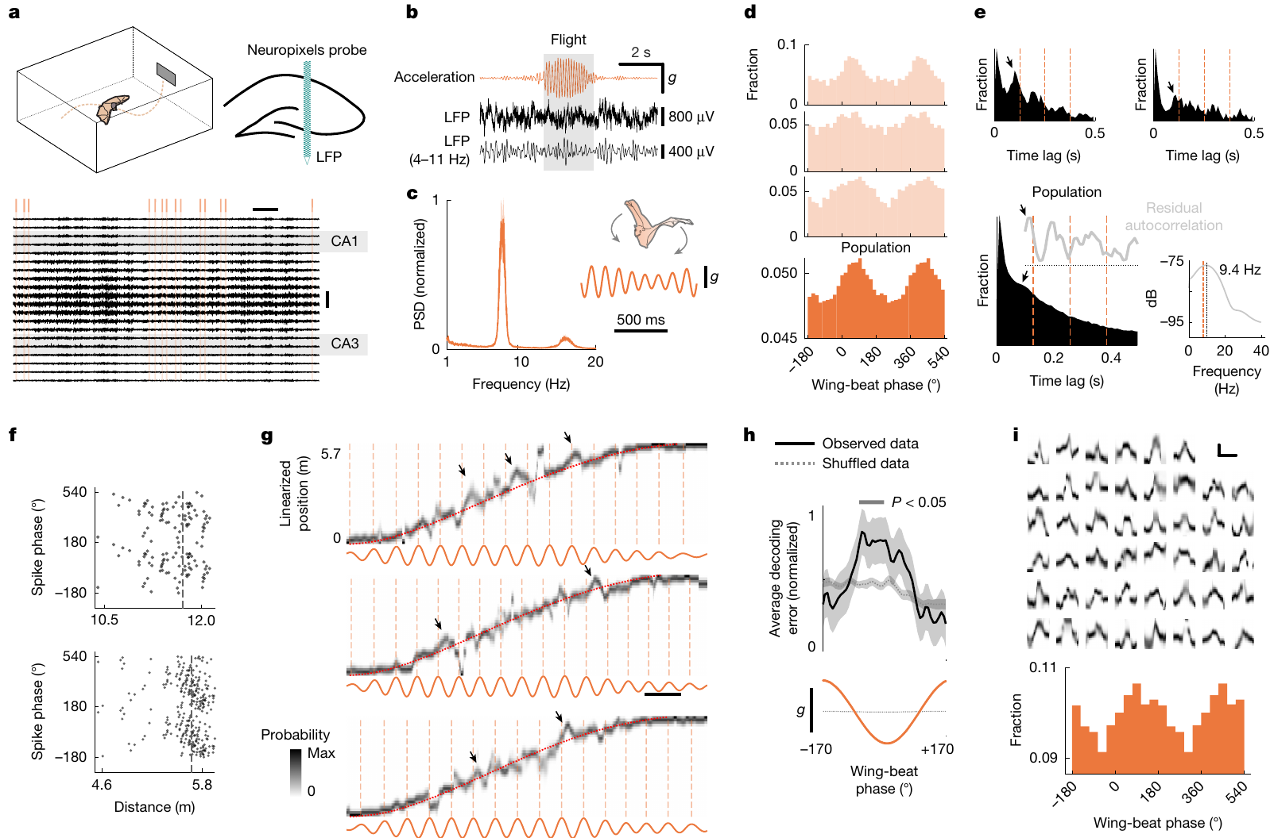
Flight-related representations track a motor rhythm
Forli and colleagues tracked how hippocampal population representations shifted during ongoing flight. The recordings contained no sustained locomotor theta oscillations, the rhythmic field-potential pattern classically linked to rodent spatial processing.
Accelerometers, by contrast, picked up a prominent wing-beat rhythm near 8 Hz. Many place cells fired preferentially at particular wing-beat phases, and the decoded position swept ahead of the animal's current position in a cyclical manner. These representational sweeps occurred even though the measured field potential lacked continuous theta.
This coupling links a species-specific motor rhythm, the wing beat, to the timing of population coding in the hippocampus. The observation therefore connects the animal's own movement to the structure of its spatial representation during flight.
Snyder et al. (2024), Fig. 1(d). Recorded dorsal hippocampus with electrode tracks and a 500-µm scale bar.
Forli et al. (2025), Fig. 3(a–k). Representational sweeps and wing-beat phase during flight.
Forli et al. (2025); Snyder et al. (2024)
41
Notes:
• During flight, Forli and colleagues examined how hippocampal population representations changed within ongoing behavior. The recordings did not contain sustained locomotor theta oscillations, a rhythmic field-potential pattern classically associated with rodent spatial processing.
• Accelerometers instead detected a prominent wing-beat rhythm near 8 Hz. Many place cells fired preferentially at particular wing-beat phases, and decoded position swept ahead of the animal’s current position cyclically. These representational sweeps occurred despite the absence of continuous theta in the measured field potential.
– An accelerometer records movement-related acceleration and supplies an independent measure of wing-beat timing. Phase locking means that spike probability depends on the position within a repeated cycle. A rhythmic relationship can arise through sensory feedback, shared drive or another interaction, and the recording alone does not select among those mechanisms.
• The observation supports coupling between a species-specific motor rhythm and population coding. It does not prove that wing beats generate the neural sweeps or that a particular channel or sensory feedback pathway mediates their timing. Correlated rhythms constrain proposed mechanisms while remaining different from experimentally established causal links.
References:
Angelo Forli; Wudi Fan; Kevin K. Qi; Michael M. Yartsev (2025). Replay and representation dynamics in the hippocampus of freely flying bats. Nature 645(8082): 974-980. https://doi.org/10.1038/s41586-025-09341-z
Madeleine C. Snyder; Kevin K. Qi; Michael M. Yartsev (2024). Neural representation of human experimenters in the bat hippocampus. Nature Neuroscience 27(9): 1675-1679. https://doi.org/10.1038/s41593-024-01690-8
Figure: Forli et al. (2025), Fig. 3(a–k). Representational sweeps and wing-beat phase during flight.
Figure source: https://doi.org/10.1038/s41586-025-09341-z
Figure: Snyder et al. (2024), Fig. 1(d). Recorded dorsal hippocampus with electrode tracks and a 500-µm scale bar.
Figure source: https://doi.org/10.1038/s41593-024-01690-8

Slide 55
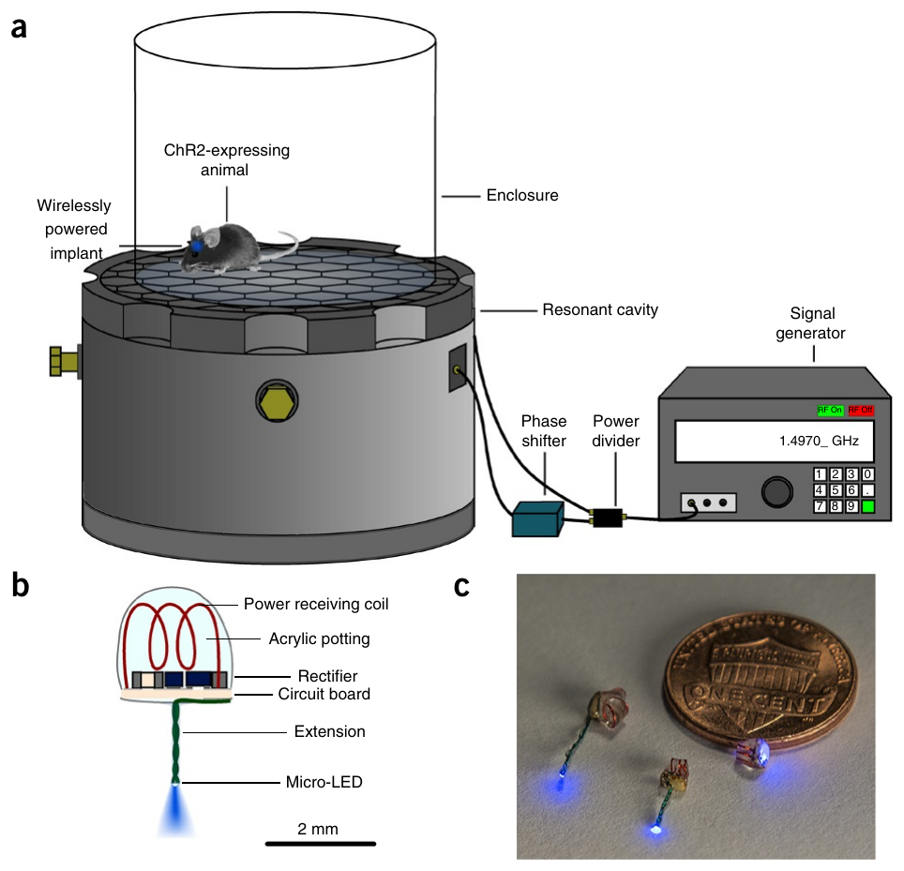
An internal implant can receive wireless optical power
For mice, Montgomery and colleagues designed light-delivery implants that sit fully inside the body. A micro-LED is a miniature light-emitting diode that converts electrical power into light near the targeted tissue. A receiving coil and local electronics drew power from an external radio-frequency apparatus.
The lightest implant weighed roughly 20 mg and filled about 10 mm³. An aluminum resonant cavity operating near 1.5 GHz concentrated electromagnetic energy in the mouse, powering a blue LED with no external fiber or battery attached to the animal.
Miniaturization allowed implantation beneath the skin and access to central or peripheral targets. The radio-frequency geometry was optimized for mice in the tested arena, so the power transfer was matched to that body size and that setup. The implant then needs no external fiber to deliver light.
Montgomery et al. (2015), Fig. 1(a–c). Wireless-power preparation and miniaturized implanted light sources.
Montgomery et al. (2015)
42
Notes:
• Montgomery and colleagues built fully internal light-delivery implants for mice. A micro-LED is a miniature light-emitting diode; it converts electrical power into light near the targeted tissue. A receiving coil and local electronics obtained power from an external radio-frequency apparatus.
• The smallest implant weighed about 20 mg and occupied about 10 mm³. An aluminum resonant cavity operating near 1.5 GHz concentrated electromagnetic energy in the mouse, powering a blue LED without an external fiber or battery attached to the animal.
– Wireless optical stimulation still uses an external power source; it removes the physical cable between that source and the animal. The receiving coil supplies the implant’s circuit, which drives the LED. The arena and receiving coil define the tested power-delivery geometry, so movement-dependent exposure remains a calibration question.
• Miniaturization enabled implantation beneath the skin and access to central or peripheral targets. The radio-frequency geometry was optimized for mice in the tested arena. These measurements do not establish equivalent power delivery in a larger animal, during unrestricted outdoor behavior or with an implant placed in any arbitrary tissue configuration.
References:
Kate L Montgomery; Alexander J Yeh; John S Ho; Vivien Tsao; Shrivats Mohan Iyer; Logan Grosenick; Emily A Ferenczi; Yuji Tanabe; Karl Deisseroth; Scott L Delp; Ada S Y Poon (2015). Wirelessly powered, fully internal optogenetics for brain, spinal and peripheral circuits in mice. Nature Methods 12(10): 969-974. https://doi.org/10.1038/nmeth.3536
Figure: Montgomery et al. (2015), Fig. 1(a–c). Wireless-power preparation and miniaturized implanted light sources.
Figure source: https://doi.org/10.1038/nmeth.3536

Slide 56
Miniature LEDs receive power wirelessly
Montgomery and colleagues built light-delivery implants for mice that sit entirely inside the body. A receiving coil and local electronics drew power from an external radio-frequency apparatus, and a micro-LED converted that power into light near the target tissue. The implant is fully internal, so no fiber leaves the skin.
The lightest implant weighed roughly 20 mg and filled about 10 mm³. An aluminum resonant cavity operating near 1.5 GHz concentrated electromagnetic energy in the mouse, which powered a blue LED with no external fiber or battery. The cavity delivered power to the implant from outside the animal.
Miniaturization allowed implantation beneath the skin and access to central or peripheral targets. The radio-frequency geometry was optimized for mice in the tested arena, so the power transfer was matched to that body size and that setup. Access to peripheral targets is therefore possible without a tether.
Montgomery et al. (2015), Fig. 1(a–c). Wireless-power preparation and miniaturized implanted light sources.
Montgomery et al. (2015)
42a
Notes:
• Miniature LEDs receive power wirelessly.
• Explanation 1.
– Montgomery and colleagues built light-delivery implants for mice that sit entirely inside the body
– A receiving coil and local electronics drew power from an external radio-frequency apparatus, and a micro-LED converted that power into light near the target tissue. The implant is fully internal, so no fiber leaves the skin.
• Explanation 2.
– The lightest implant weighed roughly 20 mg and filled about 10 mm³
– An aluminum resonant cavity operating near 1.5 GHz concentrated electromagnetic energy in the mouse, which powered a blue LED with no external fiber or battery. The cavity delivered power to the implant from outside the animal.
• Explanation 3.
– Miniaturization allowed implantation beneath the skin and access to central or peripheral targets
– The radio-frequency geometry was optimized for mice in the tested arena, so the power transfer was matched to that body size and that setup. Access to peripheral targets is therefore possible without a tether.
• Implant.
– The light-delivery implant sits entirely inside the mouse.
– A receiving coil and electronics take power from outside.
• Output.
– A micro-LED converts electrical power into light near the tissue.
– The lightest implant weighed roughly 20 mg.
• Cavity.
– An aluminum resonant cavity operated near 1.5 GHz.
– It concentrated energy in the mouse.
• Access.
– Miniaturization allowed implantation beneath the skin.
– Central and peripheral targets could be reached.
References:
Kate L Montgomery; Alexander J Yeh; John S Ho; Vivien Tsao; Shrivats Mohan Iyer; Logan Grosenick; Emily A Ferenczi; Yuji Tanabe; Karl Deisseroth; Scott L Delp; Ada S Y Poon (2015). Wirelessly powered, fully internal optogenetics for brain, spinal and peripheral circuits in mice. Nature Methods 12(10): 969-974. https://doi.org/10.1038/nmeth.3536

Slide 57
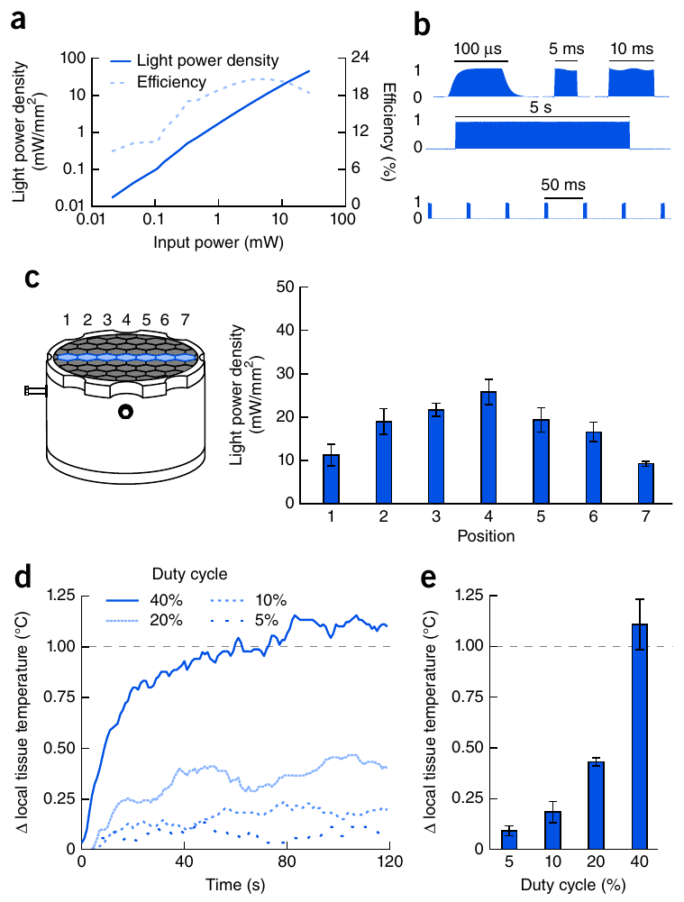
Position, pulse duty and heating constrain stimulation
A wireless implant must deliver enough light while keeping unwanted heating low. Montgomery and colleagues calibrated the LED's emitted power, pulse fidelity and position-dependent power delivery, using controlled electrical tests and measurements in a mouse-sized saline preparation.
Pulses as brief as 100 µs were produced by the device. At a fixed cavity input, the estimated light power density across the tested surface ranged from about 9.2 to 25.8 mW/mm². With 20 mW/mm² illumination, brain-adjacent tissue warmed by less than 1 °C at duty cycles up to 20%.
Duty cycle measures the share of time during which stimulation is switched on. Higher duty cycles increased heating, with rises above 1 °C near the 40% condition tested. Calibration therefore sets both the light dose and the thermal load for a given implant design. Stimulation settings thus trade light dose against heating.
Montgomery et al. (2015), Fig. 2(a–e). LED power, pulse fidelity, position dependence and tissue heating.
Montgomery et al. (2015)
43
Notes:
• A wireless implant must provide enough light while limiting unwanted heating. Montgomery and colleagues calibrated the LED’s emitted power, pulse fidelity and position-dependent power delivery, using both controlled electrical tests and measurements in a mouse-sized saline preparation.
• The device produced pulses as short as 100 µs. At a fixed cavity input, estimated light power density across the tested surface varied from approximately 9.2 to 25.8 mW/mm². Brain-adjacent measurements with 20 mW/mm² illumination remained below a 1 °C temperature rise at duty cycles up to 20%.
– A short pulse limits the duration of each exposure, but repeated pulses can still produce substantial average energy delivery. Position changes can also alter received power. Tissue temperature and delivered optical intensity must therefore be evaluated as measurements separate from the intended neuronal targeting.
• Duty cycle is the fraction of time that stimulation is on. Higher duty increased heating, with rises exceeding 1 °C near the tested 40% condition. Calibration therefore constrains dose and thermal artifacts; it does not establish identical light exposure or temperature in every tissue and behavioral position.
References:
Kate L Montgomery; Alexander J Yeh; John S Ho; Vivien Tsao; Shrivats Mohan Iyer; Logan Grosenick; Emily A Ferenczi; Yuji Tanabe; Karl Deisseroth; Scott L Delp; Ada S Y Poon (2015). Wirelessly powered, fully internal optogenetics for brain, spinal and peripheral circuits in mice. Nature Methods 12(10): 969-974. https://doi.org/10.1038/nmeth.3536
Figure: Montgomery et al. (2015), Fig. 2(a–e). LED power, pulse fidelity, position dependence and tissue heating.
Figure source: https://doi.org/10.1038/nmeth.3536

Slide 58
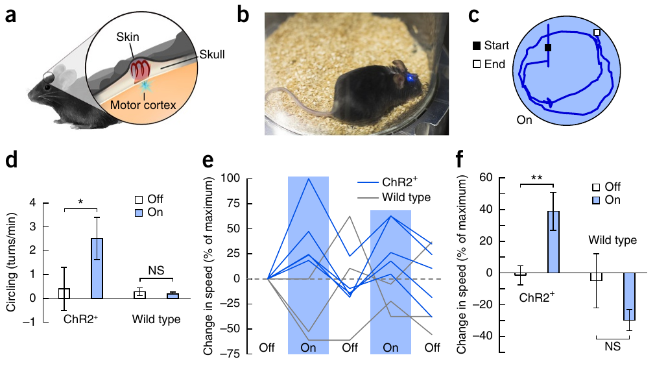
Wireless cortical stimulation changes turning behavior
Montgomery and colleagues implanted a wireless LED near the right premotor cortex, a cortical region that takes part in movement control. ChR2-expressing mice and implanted wild-type controls were tested in the same powered arena while video quantified their movement.
During 20 s stimulation epochs, 5 ms pulses at 20 Hz increased circling from about 0.40 to 2.5 turns per minute in the ChR2 group. Mean normalized locomotor speed rose by about 40%. Wild-type controls showed none of the light-dependent movement changes.
The genotype comparison links wireless stimulation to an opsin-dependent behavioral effect. Persistent circling after stimulation shows that the activated population can drive a turning behavior when light is delivered through an untethered implant.
Montgomery et al. (2015), Fig. 3(a–f). Implanted premotor-cortex stimulation and circling behavior.
Montgomery et al. (2015)
44
Notes:
• Montgomery and colleagues implanted a wireless LED near the right premotor cortex, a cortical region participating in movement control. ChR2-expressing mice and implanted wild-type controls were tested in the same powered arena while video quantified movement.
• During 20-s stimulation epochs, 5-ms pulses at 20 Hz increased circling from approximately 0.40 to 2.5 turns/min in the ChR2 group. Mean normalized locomotor speed increased by about 40%. Wild-type controls did not display the corresponding light-dependent movement changes.
– The device’s receiver remains beneath the skin while the light source enters the targeted brain region. Wild-type mice experience implantation and the radio-frequency arena without the introduced channel. Circling is quantified as a behavioral outcome rather than inferred solely from the fact that the LED emits light.
• The genotype comparison supports an opsin-dependent behavioral effect of wireless stimulation. It does not establish that natural premotor activity normally produces persistent circling, or that the activated population is necessary for every voluntary turn. The experiment validates untethered intervention while retaining the limits of imposed activation and broad expression.
References:
Kate L Montgomery; Alexander J Yeh; John S Ho; Vivien Tsao; Shrivats Mohan Iyer; Logan Grosenick; Emily A Ferenczi; Yuji Tanabe; Karl Deisseroth; Scott L Delp; Ada S Y Poon (2015). Wirelessly powered, fully internal optogenetics for brain, spinal and peripheral circuits in mice. Nature Methods 12(10): 969-974. https://doi.org/10.1038/nmeth.3536
Figure: Montgomery et al. (2015), Fig. 3(a–f). Implanted premotor-cortex stimulation and circling behavior.
Figure source: https://doi.org/10.1038/nmeth.3536

Slide 59
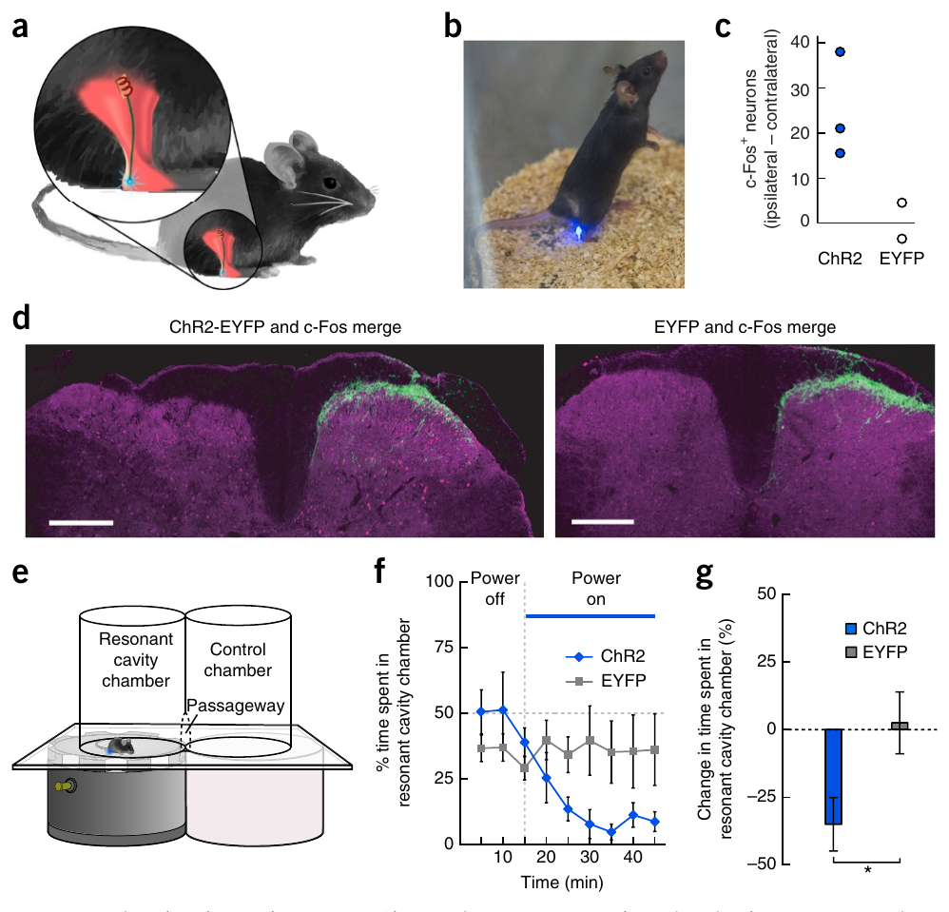
Causal claims need matched behavioral controls
A causal neural test links a specified intervention to a specified behavioral effect, and it controls for competing explanations. Montgomery and colleagues placed wireless LEDs near paw sensory endings that express ChR2 in nociceptors, neurons that detect potentially damaging stimulation.
With 10 ms pulses at 10 Hz, mice spent less time in the powered compartment during a 30 min stimulation period. Controls with the fluorescent tag alone showed no such reduction. In a complementary necessity test, Antinucci and colleagues reduced hunting after pretectal ablation, while swimming, visual escape and optomotor responses were preserved.
Activation produces an opsin-dependent aversive consequence under these conditions, and selective ablation shows a contribution to normal hunting. A behavioral claim is strongest when perturbation efficacy, anatomical targeting and preserved comparison behaviors are confirmed together.
Antinucci et al. (2019), Fig. 6(A–L). Pretectal ablation with hunting, escape and optomotor controls.
Montgomery et al. (2015), Fig. 5(a–g). Peripheral implant, sensory-fiber expression and place avoidance.
Montgomery et al. (2015); Antinucci et al. (2019)
45
Notes:
• A causal neural test must connect a defined intervention to a defined behavioral effect while controlling alternative explanations. Montgomery and colleagues placed wireless LEDs near paw sensory endings expressing ChR2 in nociceptors, neurons that detect potentially damaging stimulation.
• With 10-ms pulses at 10 Hz, mice reduced time in the powered compartment during a 30-min stimulation period; fluorescent-tag-only controls did not display the same reduction. In a complementary necessity test, Antinucci and colleagues reduced hunting after pretectal ablation while preserving swimming, visual escape and optomotor responses.
– Place avoidance is a measured change in where the mouse spends time, not a direct readout of a subjective experience. The nociceptor intervention and pretectal ablation also concern different circuits and different behaviors. Their common evidential requirement is to measure a specific consequence while retaining controls for general sensory or motor disruption.
• Activation supports an opsin-dependent aversive consequence under the tested conditions, while selective ablation supports a contribution to normal hunting. Neither result alone specifies every intervening synapse, transmitter or receptor. A behavioral claim is strongest when perturbation efficacy, anatomical targeting and preserved comparison behaviors are established together.
References:
Kate L Montgomery; Alexander J Yeh; John S Ho; Vivien Tsao; Shrivats Mohan Iyer; Logan Grosenick; Emily A Ferenczi; Yuji Tanabe; Karl Deisseroth; Scott L Delp; Ada S Y Poon (2015). Wirelessly powered, fully internal optogenetics for brain, spinal and peripheral circuits in mice. Nature Methods 12(10): 969-974. https://doi.org/10.1038/nmeth.3536
Paride Antinucci; Mónica Folgueira; Isaac H Bianco (2019). Pretectal neurons control hunting behaviour. eLife 8: e48114. https://doi.org/10.7554/elife.48114
Figure: Montgomery et al. (2015), Fig. 5(a–g). Peripheral implant, sensory-fiber expression and place avoidance.
Figure source: https://doi.org/10.1038/nmeth.3536
Figure: Antinucci et al. (2019), Fig. 6(A–L). Pretectal ablation with hunting, escape and optomotor controls.
Figure source: https://doi.org/10.7554/elife.48114

Slide 60
Key takeaways
Channel mechanism: Light-gated cation and anion channels alter conductance directly. The ionic gradient and membrane voltage determine the electrical consequence; actuator expression alone does not establish excitation or inhibition.
Sufficiency and necessity: Optical activation tests whether a targeted population can recruit an action. Ablation or verified silencing tests its contribution to normal performance. Neither intervention automatically identifies the complete natural circuit.
State dependence: The behavioral effect of neuronal activation depends on stimulation strength, preceding behavior and social history. Identical optical input need not produce an invariant action.
Measurement validity: Fluorescence requires motion and reference-channel controls. Wireless electrophysiology requires signal-fidelity and timing validation. Neither measurement is a direct causal test of behavioral function.
Comparative evidence: Annelid startle, zebrafish hunting, fly courtship and bat flight link distinct circuit arrangements to species-specific behavior. Connectomes and activity patterns constrain mechanisms without proving every functional connection.
Behavioral controls: Light-only and expression controls, anatomical verification, thermal calibration and preserved comparison behaviors limit alternative explanations. Wireless access expands behavior without removing preparation-specific constraints.
Boyden et al. (2005); Govorunova et al. (2015); Cande et al. (2018); Antinucci et al. (2019); Montgomery et al. (2015)
46
Notes:
References:
Edward S Boyden; Feng Zhang; Ernst Bamberg; Georg Nagel; Karl Deisseroth (2005). Millisecond-timescale, genetically targeted optical control of neural activity. Nature Neuroscience 8(9): 1263-1268. https://doi.org/10.1038/nn1525
Elena G. Govorunova; Oleg A. Sineshchekov; Roger Janz; Xiaoqin Liu; John L. Spudich (2015). Natural light-gated anion channels: A family of microbial rhodopsins for advanced optogenetics. Science 349(6248): 647-650. https://doi.org/10.1126/science.aaa7484
Hidehiko K Inagaki; Yonil Jung; Eric D Hoopfer; Allan M Wong; Neeli Mishra; John Y Lin; Roger Y Tsien; David J Anderson (2014). Optogenetic control of Drosophila using a red-shifted channelrhodopsin reveals experience-dependent influences on courtship. Nature Methods 11(3): 325-332. https://doi.org/10.1038/nmeth.2765
Jessica Cande; Shigehiro Namiki; Jirui Qiu; Wyatt Korff; Gwyneth M Card; Joshua W Shaevitz; David L Stern; Gordon J Berman (2018). Optogenetic dissection of descending behavioral control in Drosophila. eLife 7: e34275. https://doi.org/10.7554/elife.34275
Csaba Verasztó; Nobuo Ueda; Luis A Bezares-Calderón; Aurora Panzera; Elizabeth A Williams; Réza Shahidi; Gáspár Jékely (2017). Ciliomotor circuitry underlying whole-body coordination of ciliary activity in the Platynereis larva. eLife 6: e26000. https://doi.org/10.7554/elife.26000
Luis A Bezares-Calderón; Jürgen Berger; Sanja Jasek; Csaba Verasztó; Sara Mendes; Martin Gühmann; Rodrigo Almeda; Réza Shahidi; Gáspár Jékely (2018). Neural circuitry of a polycystin-mediated hydrodynamic startle response for predator avoidance. eLife 7: e36262. https://doi.org/10.7554/elife.36262
Paride Antinucci; Mónica Folgueira; Isaac H Bianco (2019). Pretectal neurons control hunting behaviour. eLife 8: e48114. https://doi.org/10.7554/elife.48114
Dhruv Grover; Takeo Katsuki; Jinfang Li; Thomas J. Dawkins; Ralph J. Greenspan (2020). Imaging brain activity during complex social behaviors in Drosophila with Flyception2. Nature Communications 11(1): 623. https://doi.org/10.1038/s41467-020-14487-7
Tobi A Szuts; Vitaliy Fadeyev; Sergei Kachiguine; Alexander Sher; Matthew V Grivich; Margarida Agrochão; Pawel Hottowy; Wladyslaw Dabrowski; Evgueniy V Lubenov; Athanassios G Siapas; Naoshige Uchida; Alan M Litke; Markus Meister (2011). A wireless multi-channel neural amplifier for freely moving animals. Nature Neuroscience 14(2): 263-269. https://doi.org/10.1038/nn.2730
Madeleine C. Snyder; Kevin K. Qi; Michael M. Yartsev (2024). Neural representation of human experimenters in the bat hippocampus. Nature Neuroscience 27(9): 1675-1679. https://doi.org/10.1038/s41593-024-01690-8
Angelo Forli; Wudi Fan; Kevin K. Qi; Michael M. Yartsev (2025). Replay and representation dynamics in the hippocampus of freely flying bats. Nature 645(8082): 974-980. https://doi.org/10.1038/s41586-025-09341-z
Kate L Montgomery; Alexander J Yeh; John S Ho; Vivien Tsao; Shrivats Mohan Iyer; Logan Grosenick; Emily A Ferenczi; Yuji Tanabe; Karl Deisseroth; Scott L Delp; Ada S Y Poon (2015). Wirelessly powered, fully internal optogenetics for brain, spinal and peripheral circuits in mice. Nature Methods 12(10): 969-974. https://doi.org/10.1038/nmeth.3536

