Slide 1
NEUR 411 · NEUROETHOLOGY · FALL 2026
Lecture 11
Insect vision I:
the fly optomotor response and the
Reichardt elementary motion detector
Friday, September 18, 2026
01
Notes:
Insect vision I: the fly optomotor response and the Reichardt elementary motion detector
Lecture 11. NEUR 411. Friday, September 18, 2026.

Slide 2
The fly optomotor response
An optomotor response is a compensatory movement driven by motion across the visual field. A fly viewing a rotating panorama commonly turns in the same direction as the panorama, reducing unwanted image motion.
The feedback variable is retinal slip, the movement of an image relative to the eye. Optic flow describes the pattern of these local image velocities across the visual field. Rotation and translation generate different global patterns.
During flight, unequal left and right wing strokes generate steering torque. Walking flies adjust leg movements, while head movements can stabilize gaze.
A local motion signal is ambiguous about its cause. Wide-field circuits combine signals across visual space to guide the appropriate motor response.
Bahl et al. (2013); Haikala et al. (2013); Henning et al. (2022)
02
Notes:
Bahl A, Ammer G, Schilling T, Borst A (2013). Object tracking in motion-blind flies. Nature neuroscience 16: 730-738. https://doi.org/10.1038/nn.3386
Haikala V, Joesch M, Borst A, Mauss AS (2013). Optogenetic control of fly optomotor responses. The Journal of neuroscience : the official journal of the Society for Neuroscience 33: 13927-13934. https://doi.org/10.1523/jneurosci.0340-13.2013
Henning M, Ramos-Traslosheros G, Gür B, Silies M (2022). Populations of local direction-selective cells encode global motion patterns generated by self-motion. Science advances 8: eabi7112. https://doi.org/10.1126/sciadv.abi7112

Slide 3
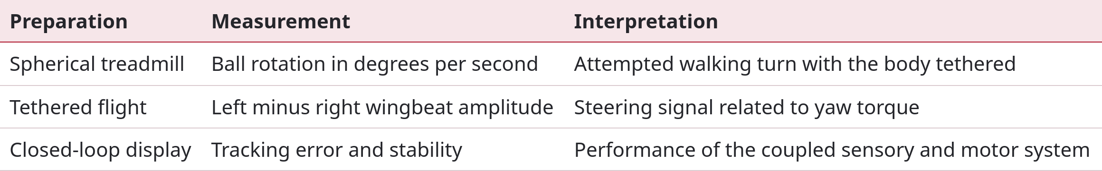
Open-loop and closed-loop experiments
A tethered fly can attempt a turn without changing its actual body heading. The preparation therefore determines what the behavioral measurement means.
In open loop, the experimenter controls the stimulus independently of the response. In closed loop, measured steering changes the displayed scene, allowing the fly to influence subsequent input. Feedback gain specifies how strongly the display responds to the animal.
Salazar-Gatzimas et al. (2016); Haikala et al. (2013); Bahl et al. (2013)
03
Notes:
Salazar-Gatzimas E, Chen J, Creamer MS, Mano O, Mandel HB, Matulis CA, Pottackal J, Clark DA (2016). Direct Measurement of Correlation Responses in Drosophila Elementary Motion Detectors Reveals Fast Timescale Tuning. Neuron 92: 227-239. https://doi.org/10.1016/j.neuron.2016.09.017
Haikala V, Joesch M, Borst A, Mauss AS (2013). Optogenetic control of fly optomotor responses. The Journal of neuroscience : the official journal of the Society for Neuroscience 33: 13927-13934. https://doi.org/10.1523/jneurosci.0340-13.2013
Bahl A, Ammer G, Schilling T, Borst A (2013). Object tracking in motion-blind flies. Nature neuroscience 16: 730-738. https://doi.org/10.1038/nn.3386

Slide 4
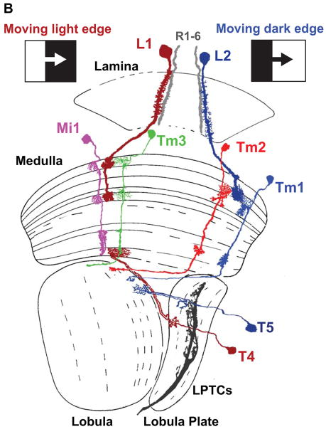
Retinotopic pathways through the optic lobe
The compound eye samples visual space with repeated units called ommatidia. R1–R6 photoreceptors provide the major input to the motion pathways considered here.
Retinotopy preserves neighborhood relations from the visual field through successive neural columns. Adjacent columns therefore carry signals from nearby image locations, providing comparisons needed for motion detection.
Lamina neurons relay signals into the medulla. T4 dendrites receive ON-pathway input in medulla layer M10. T5 dendrites receive OFF-pathway input in lobula layer Lo1.
Both classes send axons to the lobula plate. Their terminals converge on wide-field neurons according to preferred direction. The illustration shows selected routes and omits additional inputs identified by later connectomic studies.
Behnia et al. (2014), Fig. 1B. Selected anatomical pathways. LPTCs: lobula plate tangential cells.
Behnia et al. (2014); Shinomiya et al. (2019)
04
Notes:
Behnia R, Clark DA, Carter AG, Clandinin TR, Desplan C (2014). Processing properties of ON and OFF pathways for Drosophila motion detection. Nature 512: 427-430. https://doi.org/10.1038/nature13427
Shinomiya K, Huang G, Lu Z, Parag T, Xu CS, Aniceto R, Ansari N, Cheatham N, Lauchie S, Neace E, Ogundeyi O, Ordish C, Peel D, Shinomiya A, Smith C, Takemura S, Talebi I, Rivlin PK, Nern A, Scheffer LK, Plaza SM, Meinertzhagen IA (2019). Comparisons between the ON- and OFF-edge motion pathways in the Drosophila brain. eLife 8: e40025. https://doi.org/10.7554/elife.40025
Figure credit: Behnia et al. (2014), Fig. 1B. Selected anatomical pathways. LPTCs: lobula plate tangential cells.

Slide 5
Phototransduction generates a graded signal
In a fly photoreceptor, photon absorption activates rhodopsin and a signaling cascade involving phospholipase C. Light-sensitive cation channels generate a depolarizing current. Calcium entry also contributes to response regulation.
Depolarization makes membrane voltage less negative. The resulting graded signal varies continuously with stimulation. Direction information requires subsequent comparison of signals across space and time.
Hardie and Minke compared wild-type and trp mutant photoreceptors using whole-cell recordings. The mutation removed a major calcium-permeable component, and sustained responses to intense illumination decayed abnormally.
TRP-dependent current therefore helps maintain the light response. The experiment links a molecular defect to an electrical phenotype at the first stage of visual processing.
Hardie & Minke (1992); Behnia et al. (2014)
05
Notes:
Hardie RC, Minke B (1992). The trp gene is essential for a light-activated Ca2+ channel in Drosophila photoreceptors. Neuron 8: 643-651. https://doi.org/10.1016/0896-6273(92)90086-s
Behnia R, Clark DA, Carter AG, Clandinin TR, Desplan C (2014). Processing properties of ON and OFF pathways for Drosophila motion detection. Nature 512: 427-430. https://doi.org/10.1038/nature13427

Slide 6
Histamine reverses the sign at the first synapse
R1–R6 photoreceptors release histamine onto lamina targets. Histamine activates Ort-containing ligand-gated chloride channels on L1/L2 neurons. A ligand-gated channel opens when a signaling molecule binds to it.
Opening these channels increases chloride conductance and drives voltage toward the chloride reversal potential. Light increments depolarize photoreceptors while hyperpolarizing L1/L2 under the recorded conditions.
Gengs and colleagues linked ort mutations to defective photoreceptor transmission and rescued the phenotype with receptor cDNA. This connected a molecularly identified channel to its native synaptic function.
Both L1 and L2 respond to brightness increments and decrements. Later ON/OFF specialization therefore requires additional processing. Pathway names describe contributions to computation rather than exclusive responsiveness at every stage.
Gengs et al. (2002); Behnia et al. (2014); Clark et al. (2011)
06
Notes:
Gengs C, Leung HT, Skingsley DR, Iovchev MI, Yin Z, Semenov EP, Burg MG, Hardie RC, Pak WL (2002). The target of Drosophila photoreceptor synaptic transmission is a histamine-gated chloride channel encoded by ort (hclA). The Journal of biological chemistry 277: 42113-42120. https://doi.org/10.1074/jbc.m207133200
Behnia R, Clark DA, Carter AG, Clandinin TR, Desplan C (2014). Processing properties of ON and OFF pathways for Drosophila motion detection. Nature 512: 427-430. https://doi.org/10.1038/nature13427
Clark DA, Bursztyn L, Horowitz MA, Schnitzer MJ, Clandinin TR (2011). Defining the computational structure of the motion detector in Drosophila. Neuron 70: 1165-1177. https://doi.org/10.1016/j.neuron.2011.05.023

Slide 7
Direction requires space and time
A photoreceptor reports a sequence of local intensities. An increasing signal could result from a bright edge entering its field, altered illumination, or eye movement. A single intensity trace cannot determine direction.
Consider neighboring locations A and B. A feature moving from A toward B generates related contrast changes at A first and B later. Reversing motion reverses this order.
Contrast expresses a luminance difference relative to a reference level. Positive and negative signals can represent bright and dark features. Motion computations compare how signals at different positions covary over time.
A direction-selective mechanism must distinguish A-before-B from B-before-A. Spatially offset signals with asymmetric temporal filtering provide this comparison, while nonlinear interaction makes output sensitive to their coincidence.
Hassenstein & Reichardt (1956); Clark et al. (2011); Salazar-Gatzimas et al. (2016)
07
Notes:
Hassenstein B, Reichardt W (1956). Systemtheoretische Analyse der Zeit-, Reihenfolgen- und Vorzeichenauswertung bei der Bewegungsperzeption des Rüsselkäfers Chlorophanus. Zeitschrift für Naturforschung B 11: 513–524. https://doi.org/10.1515/znb-1956-9-1004
Clark DA, Bursztyn L, Horowitz MA, Schnitzer MJ, Clandinin TR (2011). Defining the computational structure of the motion detector in Drosophila. Neuron 70: 1165-1177. https://doi.org/10.1016/j.neuron.2011.05.023
Salazar-Gatzimas E, Chen J, Creamer MS, Mano O, Mandel HB, Matulis CA, Pottackal J, Clark DA (2016). Direct Measurement of Correlation Responses in Drosophila Elementary Motion Detectors Reveals Fast Timescale Tuning. Neuron 92: 227-239. https://doi.org/10.1016/j.neuron.2016.09.017

Slide 8
The original Hassenstein–Reichardt experiments
Hassenstein and Reichardt developed their early model from optomotor behavior in the beetle Chlorophanus. The historical work established a computational proposal in another insect before its extensive application to flies.
Controlled sequences of luminance changes separated spatial displacement from temporal order and contrast sign. Discrete stimulation could evoke directional behavior without a continuously translating object.
The model compares neighboring visual signals after delaying one relative to the other. A multiplication step links output to the joint occurrence of those signals.
A successful behavioral model specifies an input–output relationship. Identifying a neuron as a delay element or a synapse as a multiplier additionally requires physiological recordings, anatomy, and selective manipulation in the relevant species.
Hassenstein & Reichardt (1956); Haag et al. (2004); Behnia et al. (2014)
08
Notes:
Hassenstein B, Reichardt W (1956). Systemtheoretische Analyse der Zeit-, Reihenfolgen- und Vorzeichenauswertung bei der Bewegungsperzeption des Rüsselkäfers Chlorophanus. Zeitschrift für Naturforschung B 11: 513–524. https://doi.org/10.1515/znb-1956-9-1004
Haag J, Denk W, Borst A (2004). Fly motion vision is based on Reichardt detectors regardless of the signal-to-noise ratio. Proceedings of the National Academy of Sciences of the United States of America 101: 16333-16338. https://doi.org/10.1073/pnas.0407368101
Behnia R, Clark DA, Carter AG, Clandinin TR, Desplan C (2014). Processing properties of ON and OFF pathways for Drosophila motion detection. Nature 512: 427-430. https://doi.org/10.1038/nature13427

Slide 9
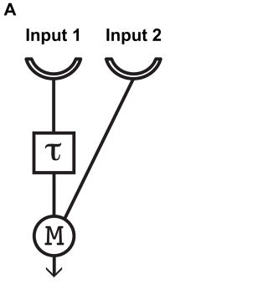
Delay and multiplication in an elementary detector
The illustrated half-detector prefers motion from input 1 toward input 2. A signal at input 1 passes through a temporal filter before interacting with input 2.
A temporal filter weights recent stimulus history. A low-pass filter smooths rapid changes and can delay a response peak. This differs from producing a perfectly timed copy of a pulse.
During suitable rightward motion, the delayed input-1 response overlaps the later input-2 response. Multiplication yields a larger signal when both are active together. Reverse-order stimulation produces less overlap.
M denotes a mathematical operation in this schematic. Experiments test which arrangements of excitatory and inhibitory conductances can implement comparable enhancement over a measured stimulus range.
Behnia et al. (2014), Fig. 1A. Model half-detector. τ: temporal filtering. M: multiplication.
Behnia et al. (2014); Hassenstein & Reichardt (1956); Groschner et al. (2022)
09
Notes:
Behnia R, Clark DA, Carter AG, Clandinin TR, Desplan C (2014). Processing properties of ON and OFF pathways for Drosophila motion detection. Nature 512: 427-430. https://doi.org/10.1038/nature13427
Hassenstein B, Reichardt W (1956). Systemtheoretische Analyse der Zeit-, Reihenfolgen- und Vorzeichenauswertung bei der Bewegungsperzeption des Rüsselkäfers Chlorophanus. Zeitschrift für Naturforschung B 11: 513–524. https://doi.org/10.1515/znb-1956-9-1004
Groschner LN, Malis JG, Zuidinga B, Borst A (2022). A biophysical account of multiplication by a single neuron. Nature 603: 119-123. https://doi.org/10.1038/s41586-022-04428-3
Figure credit: Behnia et al. (2014), Fig. 1A. Model half-detector. τ: temporal filtering. M: multiplication.

Slide 10
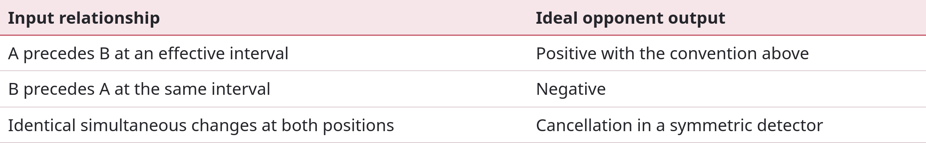
Opponent subtraction gives a signed output
A complete Reichardt detector compares mirror-symmetric half-detectors. For contrast inputs a(t) and b(t), a common expression is R(t) = aτ(t)b(t) − bτ(t)a(t). Here aτ(t) and bτ(t) denote temporally filtered inputs.
The first product favors A-before-B, while the second favors B-before-A. Their difference changes sign when direction reverses. Subtraction reduces nondirectional components shared by the branches.
A signed population output can emerge when downstream neurons combine oppositely tuned cells, even when each cell’s activity is nonnegative.
Hassenstein & Reichardt (1956); Mauss et al. (2015); Salazar-Gatzimas et al. (2016)
10
Notes:
Hassenstein B, Reichardt W (1956). Systemtheoretische Analyse der Zeit-, Reihenfolgen- und Vorzeichenauswertung bei der Bewegungsperzeption des Rüsselkäfers Chlorophanus. Zeitschrift für Naturforschung B 11: 513–524. https://doi.org/10.1515/znb-1956-9-1004
Mauss AS, Pankova K, Arenz A, Nern A, Rubin GM, Borst A (2015). Neural Circuit to Integrate Opposing Motions in the Visual Field. Cell 162: 351-362. https://doi.org/10.1016/j.cell.2015.06.035
Salazar-Gatzimas E, Chen J, Creamer MS, Mano O, Mandel HB, Matulis CA, Pottackal J, Clark DA (2016). Direct Measurement of Correlation Responses in Drosophila Elementary Motion Detectors Reveals Fast Timescale Tuning. Neuron 92: 227-239. https://doi.org/10.1016/j.neuron.2016.09.017

Slide 11
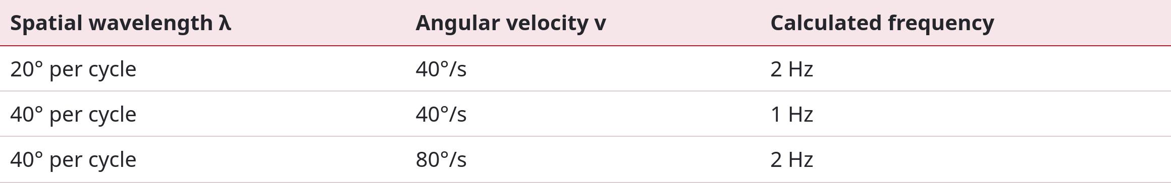
Temporal frequency and image velocity
For a drifting grating, f = v/λ, where f is temporal frequency, v is angular velocity, and λ is angular spatial wavelength. Temporal frequency counts contrast cycles passing a fixed retinal location each second.
Reichardt responses depend on pattern as well as speed. Changing wavelength can shift the velocity producing the strongest response while preferred temporal frequency remains similar.
Haag, Denk, and Borst tested this signature across luminance and contrast. Wavelength dependence persisted across the tested signal-to-noise range. The examples below are calculations, separate from those experimental measurements.
Haag et al. (2004); Single & Borst (1998)
11
Notes:
Haag J, Denk W, Borst A (2004). Fly motion vision is based on Reichardt detectors regardless of the signal-to-noise ratio. Proceedings of the National Academy of Sciences of the United States of America 101: 16333-16338. https://doi.org/10.1073/pnas.0407368101
Single S, Borst A (1998). Dendritic integration and its role in computing image velocity. Science (New York, N.Y.) 281: 1848-1850. https://doi.org/10.1126/science.281.5384.1848

Slide 12
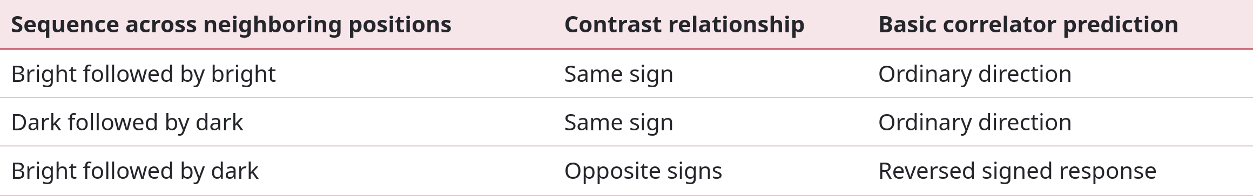
Contrast reversal and reverse-phi motion
In ordinary apparent motion, a displaced feature retains its contrast sign. In reverse-phi motion, displacement accompanies contrast reversal, such as bright becoming dark.
The simplest correlator predicts a response reversal because the product of opposite-sign signals is negative. Flies can consequently turn opposite to the physical displacement of the pattern.
ON/OFF pathways complicate this calculation. Rectification suppresses one polarity, while tonic signals and additional interactions preserve sensitivity to some contrast-reversing sequences. Stimulus timing and luminance history matter when comparing predictions.
Clark et al. (2011); Eichner et al. (2011); Leonhardt et al. (2017)
12
Notes:
Clark DA, Bursztyn L, Horowitz MA, Schnitzer MJ, Clandinin TR (2011). Defining the computational structure of the motion detector in Drosophila. Neuron 70: 1165-1177. https://doi.org/10.1016/j.neuron.2011.05.023
Eichner H, Joesch M, Schnell B, Reiff DF, Borst A (2011). Internal structure of the fly elementary motion detector. Neuron 70: 1155-1164. https://doi.org/10.1016/j.neuron.2011.03.028
Leonhardt A, Meier M, Serbe E, Eichner H, Borst A (2017). Neural mechanisms underlying sensitivity to reverse-phi motion in the fly. PloS one 12: e0189019. https://doi.org/10.1371/journal.pone.0189019

Slide 13
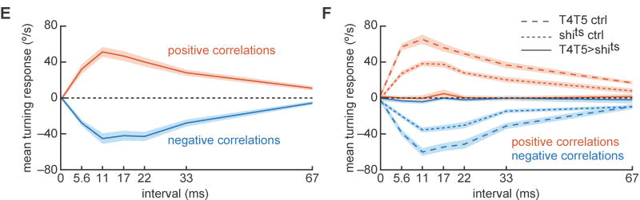
Measured sensitivity to temporal correlations
Salazar-Gatzimas et al. (2016), Fig. 1E–F. E: n = 15 flies. F: experimental n = 15, driver control n = 15, effector control n = 20.
Salazar-Gatzimas and colleagues presented panoramic noise with controlled spatial and temporal correlations to flies walking on a ball. The stimulus isolated a correlation interval without translating a recognizable object.
Panel F tests necessity. Blocking T4/T5 output with temperature-sensitive shibire abolished correlation-driven turning, while both genetic controls retained it.
The intervals characterize this stimulus and preparation. They constrain the computation but cannot be equated with the decay constant of every contributing neuron.
Panel E plots measured turning velocity against interval. Fifteen flies responded most strongly at 11–22 ms. Positive and negative correlations drove turns with opposite signs. Shading represents SEM.
Salazar-Gatzimas et al. (2016)
13
Notes:
Salazar-Gatzimas E, Chen J, Creamer MS, Mano O, Mandel HB, Matulis CA, Pottackal J, Clark DA (2016). Direct Measurement of Correlation Responses in Drosophila Elementary Motion Detectors Reveals Fast Timescale Tuning. Neuron 92: 227-239. https://doi.org/10.1016/j.neuron.2016.09.017
Figure credit: Salazar-Gatzimas et al. (2016), Fig. 1E–F. E: n = 15 flies. F: experimental n = 15, driver control n = 15, effector control n = 20.

Slide 14
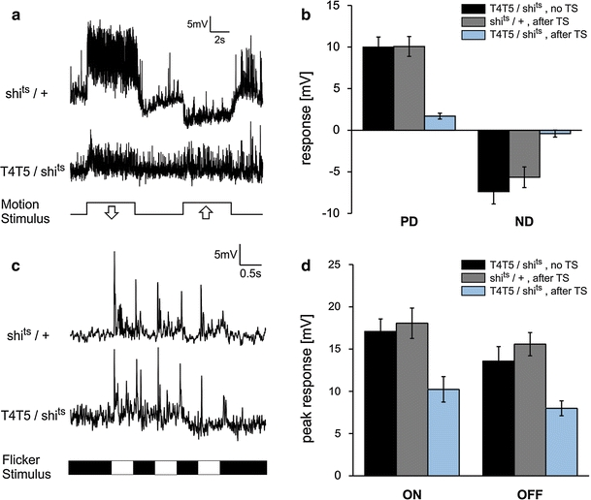
T4/T5 output is necessary for motion responses
Schnell and colleagues recorded from wide-field lobula plate neurons while blocking T4/T5 output. Temperature-sensitive shibire disrupts synaptic vesicle recycling at restrictive temperature.
Before blockade, preferred-direction gratings depolarized the recorded cells and null-direction gratings hyperpolarized them. After blockade, both directional responses were nearly abolished.
The lower panels show substantial residual responses to uniform light transitions. Preserved flicker responses demonstrate that recorded neurons remained responsive to visual input.
Temperature-treated genetic controls retained motion responses. An independent manipulation using the inward-rectifier potassium channel Kir2.1 supported the conclusion: T4/T5 supply principal motion-sensitive input, while additional pathways convey luminance changes.
Schnell et al. (2012), Fig. 2. Original voltage traces and group means. TS: temperature shift. PD/ND: preferred/null direction.
Schnell et al. (2012)
14
Notes:
Schnell B, Raghu SV, Nern A, Borst A (2012). Columnar cells necessary for motion responses of wide-field visual interneurons in Drosophila. Journal of comparative physiology. A, Neuroethology, sensory, neural, and behavioral physiology 198: 389-395. https://doi.org/10.1007/s00359-012-0716-3
Figure credit: Schnell et al. (2012), Fig. 2. Original voltage traces and group means. TS: temperature shift. PD/ND: preferred/null direction.

Slide 15
L1 and L2 contribute differently to ON and OFF motion
An ON edge increases luminance at a location, whereas an OFF edge decreases it. A moving grating contains both transitions and can conceal pathway differences.
Joesch and colleagues combined selective lamina manipulations with downstream voltage recordings. Blocking L1 impaired ON-edge responses, whereas blocking L2 impaired OFF-edge responses.
Restoring photoreceptor input to a single pathway could nevertheless support strong grating responses. Electrical coupling between L1 and L2 offered an explanation for the apparent discrepancy between blocking and restoration.
These results concern pathway contributions under particular stimulus conditions. Subsequent work showed OFF-motion contributions from L1 and L3, and demonstrated that both L1 and L2 encode brightness changes of either sign.
Joesch et al. (2010); Clark et al. (2011); Behnia et al. (2014)
15
Notes:
Joesch M, Schnell B, Raghu SV, Reiff DF, Borst A (2010). ON and OFF pathways in Drosophila motion vision. Nature 468: 300-304. https://doi.org/10.1038/nature09545
Clark DA, Bursztyn L, Horowitz MA, Schnitzer MJ, Clandinin TR (2011). Defining the computational structure of the motion detector in Drosophila. Neuron 70: 1165-1177. https://doi.org/10.1016/j.neuron.2011.05.023
Behnia R, Clark DA, Carter AG, Clandinin TR, Desplan C (2014). Processing properties of ON and OFF pathways for Drosophila motion detection. Nature 512: 427-430. https://doi.org/10.1038/nature13427

Slide 16
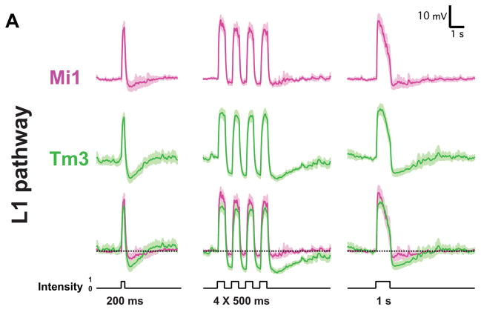
Rectification in medulla relay neurons
Rectification means transmitting one sign of an input more strongly than the other. This helps convert bipolar lamina signals into pathways specialized for brightness increments or decrements.
Behnia and colleagues made whole-cell recordings from identified medulla neurons in awake, immobilized flies. Mi1 and Tm3 depolarized strongly at light onset and responded more weakly with opposite polarity at offset.
Brief flashes, repeated flashes, and a one-second step reveal transient and sustained response components. The displayed measurements included seven Mi1 and ten Tm3 cells.
Tm1 and Tm2 showed complementary emphasis on brightness decrements. These relays supply contrast-dependent input to motion detectors, but their responses lacked the strong directional selectivity characteristic of T4/T5.
Behnia et al. (2014), Fig. 2A. Mean voltage ± SEM. The lower trace in each group overlays the two cell types.
Behnia et al. (2014); Clark et al. (2011)
16
Notes:
Behnia R, Clark DA, Carter AG, Clandinin TR, Desplan C (2014). Processing properties of ON and OFF pathways for Drosophila motion detection. Nature 512: 427-430. https://doi.org/10.1038/nature13427
Clark DA, Bursztyn L, Horowitz MA, Schnitzer MJ, Clandinin TR (2011). Defining the computational structure of the motion detector in Drosophila. Neuron 70: 1165-1177. https://doi.org/10.1016/j.neuron.2011.05.023
Figure credit: Behnia et al. (2014), Fig. 2A. Mean voltage ± SEM. The lower trace in each group overlays the two cell types.

Slide 17
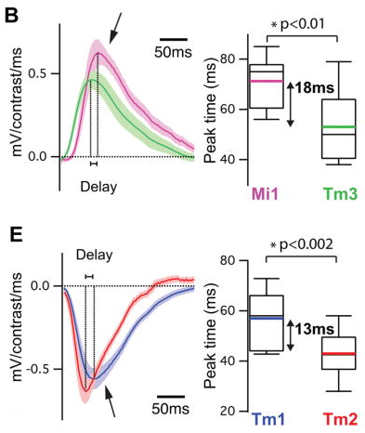
Measured temporal filters in the input pathways
A linear temporal filter estimates how preceding stimulus fluctuations contribute to voltage. Behnia and colleagues derived filters from random luminance stimulation.
Mi1 filters peaked at 71 ± 3.8 ms, compared with 53 ± 5.2 ms for Tm3. The 18 ms difference had p < 0.01. Tm1 peaked at 56 ± 3.8 ms, compared with 43 ± 2.7 ms for Tm2, a 13 ms difference with p < 0.002.
These are mean peak times ± SEM, incorporating processing throughout the upstream pathway rather than measuring axonal conduction alone.
The delays constrain candidate computations. Circuit assignments additionally require positions, signs, and strengths of synaptic inputs, which later connectomic studies expanded.
Behnia et al. (2014), Fig. 3B,E, stacked. ON: Mi1 n = 7, Tm3 n = 11. OFF: Tm1 n = 15, Tm2 n = 14.
Behnia et al. (2014); Takemura et al. (2017); Arenz et al. (2017)
17
Notes:
Behnia R, Clark DA, Carter AG, Clandinin TR, Desplan C (2014). Processing properties of ON and OFF pathways for Drosophila motion detection. Nature 512: 427-430. https://doi.org/10.1038/nature13427
Takemura SY, Nern A, Chklovskii DB, Scheffer LK, Rubin GM, Meinertzhagen IA (2017). The comprehensive connectome of a neural substrate for 'ON' motion detection in Drosophila. eLife 6: e24394. https://doi.org/10.7554/elife.24394
Arenz A, Drews MS, Richter FG, Ammer G, Borst A (2017). The Temporal Tuning of the Drosophila Motion Detectors Is Determined by the Dynamics of Their Input Elements. Current biology : CB 27: 929-944. https://doi.org/10.1016/j.cub.2017.01.051
Figure credit: Behnia et al. (2014), Fig. 3B,E, stacked. ON: Mi1 n = 7, Tm3 n = 11. OFF: Tm1 n = 15, Tm2 n = 14.

Slide 18

T4 and T5 encode direction and edge polarity
Maisak and colleagues imaged T4/T5 calcium using GCaMP5. T4 preferred moving brightness increments, whereas T5 preferred decrements. Cells with matching directional preferences terminated in the same lobula plate layer.
Selective output blockade linked tuning to function. T4 blockade compromised ON-edge responses and turning, while T5 blockade compromised OFF-edge responses and turning. Gratings contain both transitions, so selective deficits depend on stimulus composition.
The four-direction map below describes traditional local preferences. Larger visual-field measurements reveal systematic variation within each projection layer.
Maisak et al. (2013); Henning et al. (2022)
18
Notes:
Maisak MS, Haag J, Ammer G, Serbe E, Meier M, Leonhardt A, Schilling T, Bahl A, Rubin GM, Nern A, Dickson BJ, Reiff DF, Hopp E, Borst A (2013). A directional tuning map of Drosophila elementary motion detectors. Nature 500: 212-216. https://doi.org/10.1038/nature12320
Henning M, Ramos-Traslosheros G, Gür B, Silies M (2022). Populations of local direction-selective cells encode global motion patterns generated by self-motion. Science advances 8: eabi7112. https://doi.org/10.1126/sciadv.abi7112

Slide 19
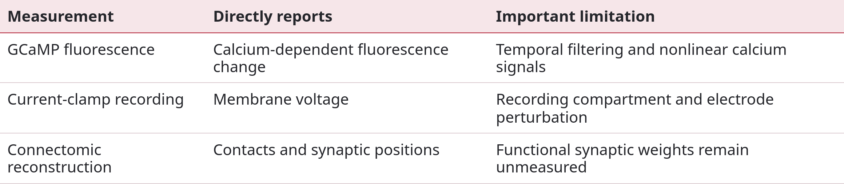
Calcium signals and membrane voltage
Calcium imaging and electrophysiology report different transformations of activity. Calcium fluorescence depends on calcium entry, buffering, clearance, and indicator kinetics.
For fluorescence, ΔF/F = (F − F₀)/F₀, where F₀ is a reference level. A nonlinear calcium signal can amplify a small difference between voltage responses.
Whole-cell recordings resolve rapid depolarization and hyperpolarization, but somatic voltage can differ from dendritic voltage. Comparisons require matched stimulus size, timing, and recording compartment. These distinctions help reconcile different accounts of the motion computation.
Gruntman et al. (2018); Leong et al. (2016); Behnia et al. (2014)
19
Notes:
Gruntman E, Romani S, Reiser MB (2018). Simple integration of fast excitation and offset, delayed inhibition computes directional selectivity in Drosophila. Nature neuroscience 21: 250-257. https://doi.org/10.1038/s41593-017-0046-4
Leong JC, Esch JJ, Poole B, Ganguli S, Clandinin TR (2016). Direction Selectivity in Drosophila Emerges from Preferred-Direction Enhancement and Null-Direction Suppression. The Journal of neuroscience : the official journal of the Society for Neuroscience 36: 8078-8092. https://doi.org/10.1523/jneurosci.1272-16.2016
Behnia R, Clark DA, Carter AG, Clandinin TR, Desplan C (2014). Processing properties of ON and OFF pathways for Drosophila motion detection. Nature 512: 427-430. https://doi.org/10.1038/nature13427

Slide 20
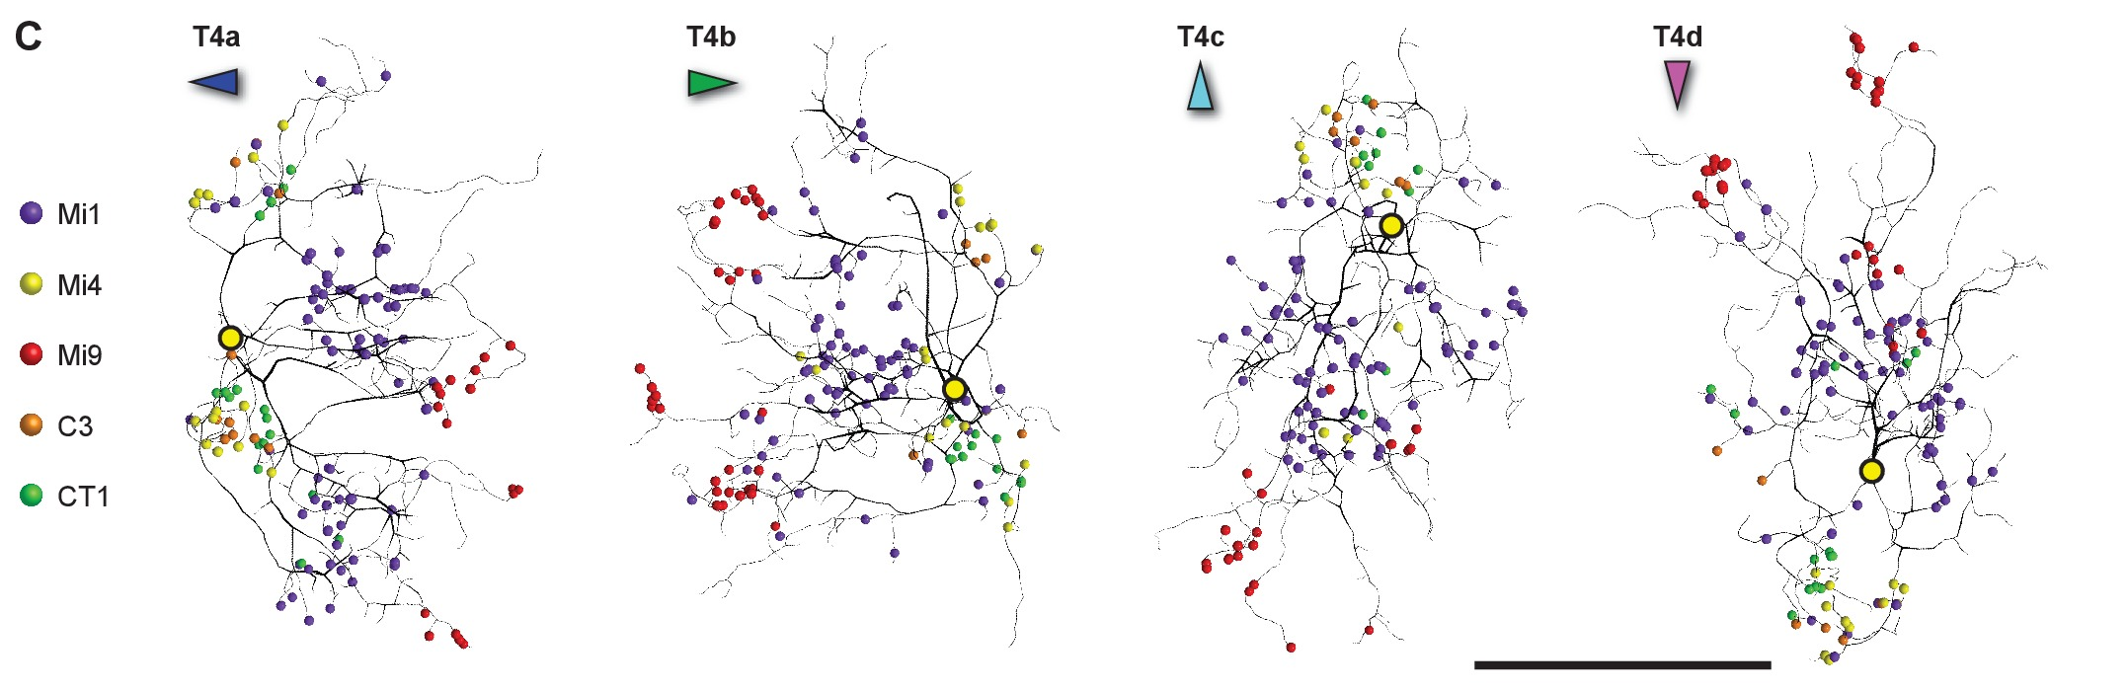
Spatially segregated inputs on a T4 dendrite
Takemura et al. (2017), Fig. 4C. Original synaptic distributions on T4a–d dendrites. Colored contacts identify input classes.
A connectome maps connections at synaptic resolution. Takemura and colleagues reconstructed seven medulla columns and identified multiple T4 input classes.
Mi9 accounted for 13.3%, Mi4 for 6.4%, and C3 for 3.9% of T4 input contacts in the reconstructed dataset. Contact fractions describe anatomy and cannot directly substitute for physiological synaptic strengths.
Mi9 synapses cluster near dendritic tips, Mi1 and Tm3 occupy more central regions, and Mi4, C3, and CT1 contact the proximal region. Each location samples a different spatially offset source.
The arrangement constrains enhancement and suppression models. Transmitter identity, receptor expression, and input timing determine how these contacts change membrane voltage during motion.
Takemura et al. (2017); Shinomiya et al. (2019)
20
Notes:
Takemura SY, Nern A, Chklovskii DB, Scheffer LK, Rubin GM, Meinertzhagen IA (2017). The comprehensive connectome of a neural substrate for 'ON' motion detection in Drosophila. eLife 6: e24394. https://doi.org/10.7554/elife.24394
Shinomiya K, Huang G, Lu Z, Parag T, Xu CS, Aniceto R, Ansari N, Cheatham N, Lauchie S, Neace E, Ogundeyi O, Ordish C, Peel D, Shinomiya A, Smith C, Takemura S, Talebi I, Rivlin PK, Nern A, Scheffer LK, Plaza SM, Meinertzhagen IA (2019). Comparisons between the ON- and OFF-edge motion pathways in the Drosophila brain. eLife 8: e40025. https://doi.org/10.7554/elife.40025
Figure credit: Takemura et al. (2017), Fig. 4C. Original synaptic distributions on T4a–d dendrites. Colored contacts identify input classes.

Slide 21
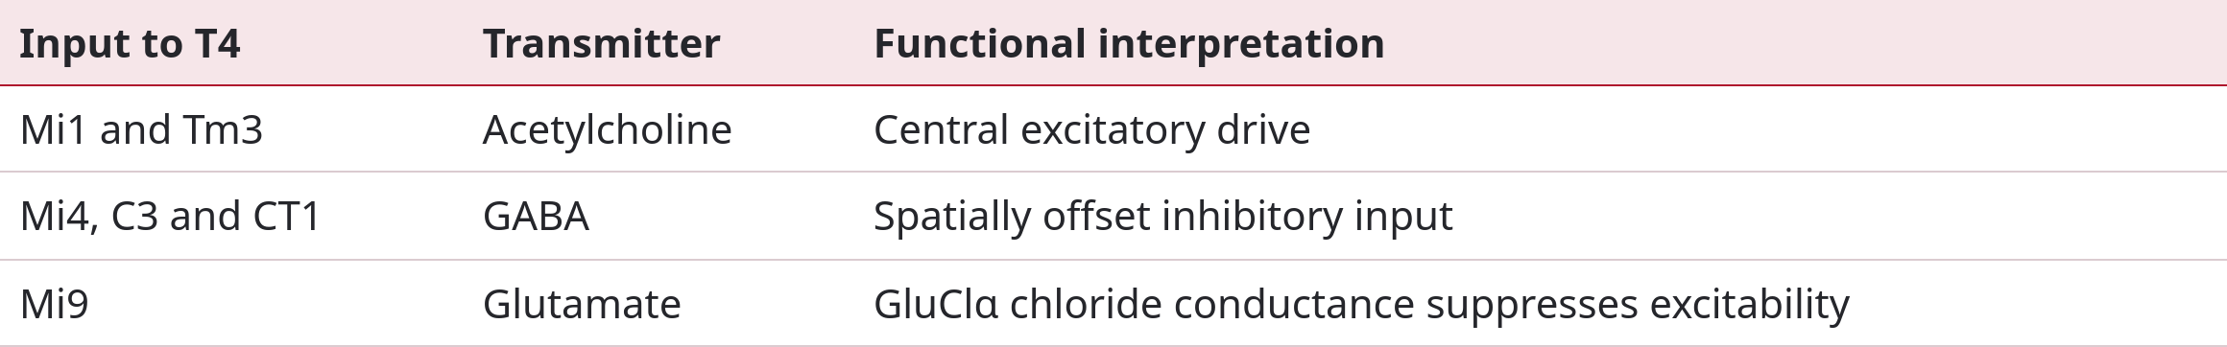
Transmitters and receptors set the synaptic sign
A transmitter’s effect depends on its receptor and ionic driving force. Glutamate can inhibit a fly visual neuron by opening chloride channels, while acetylcholine commonly supplies excitation.
Central cholinergic inputs and spatially offset inhibitory inputs interact on T4 dendrites. Molecular expression supports candidate receptor assignments, while direct transmitter application and receptor perturbation test their physiological effects.
The table distinguishes established transmitter classes from the specific receptor mechanism tested for Mi9-associated inhibition. A contact alone cannot determine whether its effect is excitatory, inhibitory, or modulatory.
Groschner et al. (2022); Strother et al. (2017); Takemura et al. (2017)
21
Notes:
Groschner LN, Malis JG, Zuidinga B, Borst A (2022). A biophysical account of multiplication by a single neuron. Nature 603: 119-123. https://doi.org/10.1038/s41586-022-04428-3
Strother JA, Wu ST, Wong AM, Nern A, Rogers EM, Le JQ, Rubin GM, Reiser MB (2017). The Emergence of Directional Selectivity in the Visual Motion Pathway of Drosophila. Neuron 94: 168-182.e10. https://doi.org/10.1016/j.neuron.2017.03.010
Takemura SY, Nern A, Chklovskii DB, Scheffer LK, Rubin GM, Meinertzhagen IA (2017). The comprehensive connectome of a neural substrate for 'ON' motion detection in Drosophila. eLife 6: e24394. https://doi.org/10.7554/elife.24394

Slide 22
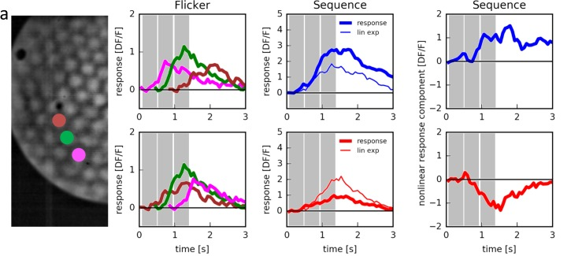
Apparent motion isolates nonlinear interactions
Haag et al. (2016), Fig. 3A. Three-step apparent motion. Thick traces: measured response. Thin traces: summed single-flash responses.
Haag and colleagues presented sequential brief flashes at neighboring positions while imaging T4 calcium. The displayed experiment uses three positions. Reversing their order reverses apparent motion without changing the sampled locations.
T4 responses showed preferred-direction enhancement and null-direction suppression in different regions of the receptive field. The single-flash sum supplied the essential linear comparison.
They compared the sequence response with the time-aligned sum of responses to each flash alone. A larger sequence response indicates enhancement, while a smaller response indicates suppression.
These results identify nonlinear interactions in calcium. Membrane recordings and receptor perturbations test the synaptic conductances that generate the electrical response.
Haag et al. (2016); Gruntman et al. (2018)
22
Notes:
Haag J, Arenz A, Serbe E, Gabbiani F, Borst A (2016). Complementary mechanisms create direction selectivity in the fly. eLife 5: e17421. https://doi.org/10.7554/elife.17421
Gruntman E, Romani S, Reiser MB (2018). Simple integration of fast excitation and offset, delayed inhibition computes directional selectivity in Drosophila. Nature neuroscience 21: 250-257. https://doi.org/10.1038/s41593-017-0046-4
Figure credit: Haag et al. (2016), Fig. 3A. Three-step apparent motion. Thick traces: measured response. Thin traces: summed single-flash responses.

Slide 23
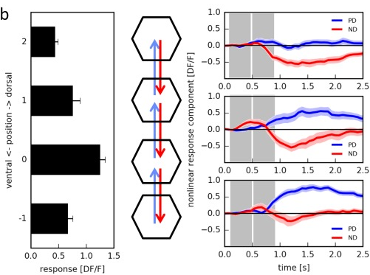
Enhancement and suppression occupy different positions
A receptive field is the region of sensory space in which stimulation influences a neuron. Mapping the same flash sequence across positions reveals where nonlinear interactions occur.
Haag and colleagues tested T4 cells with apparent motion along their preferred–null axis. Preferred-direction enhancement and null-direction suppression were spatially displaced rather than uniformly distributed across the field.
The population measurements comprised 15 cells from 11 flies. Position-specific effects constrain models more strongly than an overall direction-tuning curve alone.
A circuit can combine an enhancing interaction on one side with a suppressing interaction on the other. Anatomical input positions and measured response delays determine which stimulus order engages each component.
Haag et al. (2016), Fig. 3B. Two-step apparent motion at different positions. Mean ± SEM, 15 cells in 11 flies.
Haag et al. (2016); Takemura et al. (2017)
23
Notes:
Haag J, Arenz A, Serbe E, Gabbiani F, Borst A (2016). Complementary mechanisms create direction selectivity in the fly. eLife 5: e17421. https://doi.org/10.7554/elife.17421
Takemura SY, Nern A, Chklovskii DB, Scheffer LK, Rubin GM, Meinertzhagen IA (2017). The comprehensive connectome of a neural substrate for 'ON' motion detection in Drosophila. eLife 6: e24394. https://doi.org/10.7554/elife.24394
Figure credit: Haag et al. (2016), Fig. 3B. Two-step apparent motion at different positions. Mean ± SEM, 15 cells in 11 flies.

Slide 24
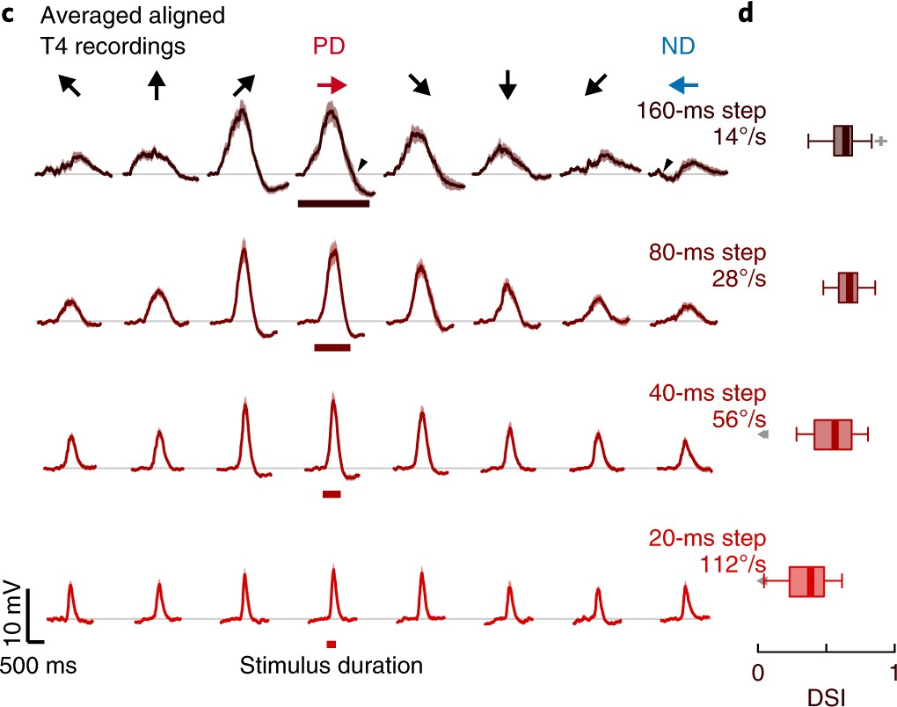
T4 voltage reveals direction-selective depolarization
Gruntman and colleagues recorded T4 membrane voltage with whole-cell electrodes. Moving ON bars produced larger depolarizations in preferred than null directions.
The experiments tested 14–112°/s and recorded 17 cells. Directional differences in peak amplitude and response dynamics appeared in the voltage signal itself.
Panel D reports DSI = [R(PD) − R(ND)]/R(PD). R is response amplitude estimated using the 0.995 voltage quantile, a robust peak estimate.
Selectivity was stronger at slower speeds. The study emphasized delayed inhibition and null-direction suppression. Comparisons with calcium-based enhancement require matched stimulus conditions and recording compartments.
Gruntman et al. (2018), Fig. 1C–D. Direction-aligned voltage responses and direction-selectivity index. Four speeds: 14, 28, 56, and 112°/s.
Gruntman et al. (2018); Haag et al. (2016)
24
Notes:
Gruntman E, Romani S, Reiser MB (2018). Simple integration of fast excitation and offset, delayed inhibition computes directional selectivity in Drosophila. Nature neuroscience 21: 250-257. https://doi.org/10.1038/s41593-017-0046-4
Haag J, Arenz A, Serbe E, Gabbiani F, Borst A (2016). Complementary mechanisms create direction selectivity in the fly. eLife 5: e17421. https://doi.org/10.7554/elife.17421
Figure credit: Gruntman et al. (2018), Fig. 1C–D. Direction-aligned voltage responses and direction-selectivity index. Four speeds: 14, 28, 56, and 112°/s.

Slide 25
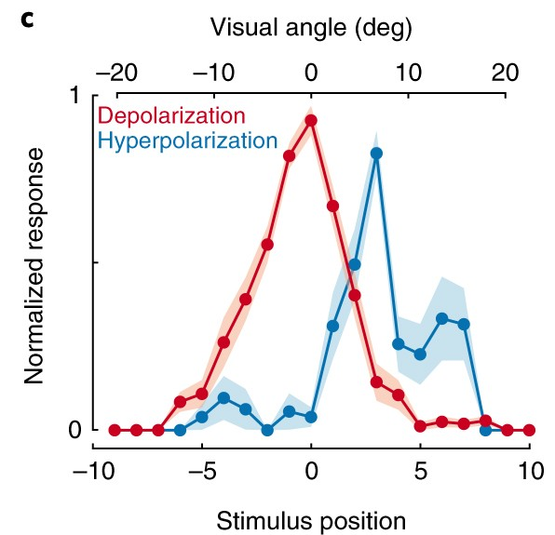
The spatial profile of T4 excitation and inhibition
Stationary flashes separate receptive-field structure from motion. Gruntman and colleagues placed bright bars at successive positions along each T4 neuron’s preferred–null axis.
Central stimulation produced depolarization. Spatially displaced stimuli revealed hyperpolarizing components with different timing. A moving bar encounters these components in a direction-dependent order.
When inhibitory influence overlaps excitation during null-direction motion, the voltage response is reduced. Reversing the sequence changes that overlap and preserves a larger preferred-direction response.
The recorded receptive-field structure supports a conductance model that predicts responses to moving stimuli. Hyperpolarization provides evidence about voltage, while receptor perturbation is required to identify the underlying transmitter and channel.
Gruntman et al. (2018), Fig. 2C. Normalized peak depolarization and hyperpolarization across stimulus positions.
Gruntman et al. (2018); Groschner et al. (2022)
25
Notes:
Gruntman E, Romani S, Reiser MB (2018). Simple integration of fast excitation and offset, delayed inhibition computes directional selectivity in Drosophila. Nature neuroscience 21: 250-257. https://doi.org/10.1038/s41593-017-0046-4
Groschner LN, Malis JG, Zuidinga B, Borst A (2022). A biophysical account of multiplication by a single neuron. Nature 603: 119-123. https://doi.org/10.1038/s41586-022-04428-3
Figure credit: Gruntman et al. (2018), Fig. 2C. Normalized peak depolarization and hyperpolarization across stimulus positions.

Slide 26
Conductance interactions and shunting inhibition
A conductance describes how readily ions cross a membrane. Its effect depends on the difference between membrane voltage and the associated reversal potential.
A passive model is C dV/dt = gL(EL − V) + gE(EE − V) + gI(EI − V). C is capacitance. L, E, and I denote leak, excitation, and inhibition.
An inhibitory conductance can reduce excitability with little hyperpolarization. Increased total conductance lowers input resistance and diminishes the voltage caused by an excitatory current. This is shunting inhibition.
Removing that conductance raises resistance. Excitation arriving during release from inhibition can produce a disproportionately large voltage change. Multiplication-like interactions can consequently emerge from passive membrane properties.
Gruntman et al. (2018); Groschner et al. (2022); Gruntman et al. (2019)
26
Notes:
Gruntman E, Romani S, Reiser MB (2018). Simple integration of fast excitation and offset, delayed inhibition computes directional selectivity in Drosophila. Nature neuroscience 21: 250-257. https://doi.org/10.1038/s41593-017-0046-4
Groschner LN, Malis JG, Zuidinga B, Borst A (2022). A biophysical account of multiplication by a single neuron. Nature 603: 119-123. https://doi.org/10.1038/s41586-022-04428-3
Gruntman E, Romani S, Reiser MB (2019). The computation of directional selectivity in the Drosophila OFF motion pathway. eLife 8: e50706. https://doi.org/10.7554/elife.50706

Slide 27
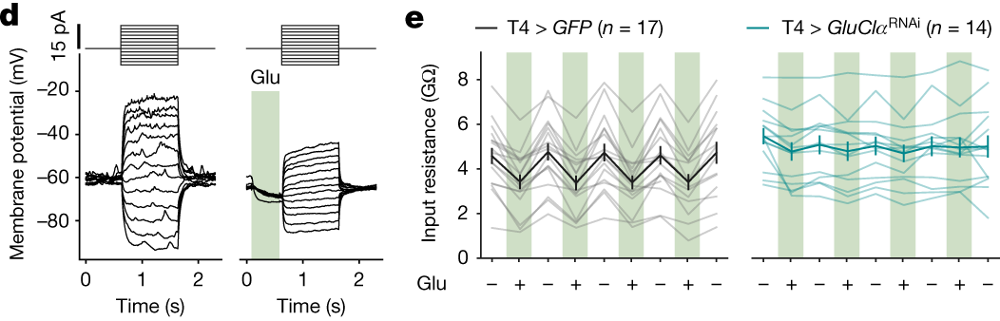
Glutamate changes T4 input resistance
Groschner et al. (2022), Fig. 2D–E. Repeated glutamate application and current injection. Thin lines: cells. Thick lines: mean ± SEM.
Groschner and colleagues applied glutamate to T4 dendrites while measuring voltage responses to injected current. Input resistance is voltage change divided by current change.
RNA interference against GluClα, a glutamate-gated chloride channel, abolished the change. The resistance assay included 17 controls and 14 knockdown cells.
Glutamate reduced input resistance by 25.27% on average. The effect reversed between applications, visible as alternating low and high resistance in control cells.
This identifies a receptor-mediated conductance regulating excitability. Mi9-derived glutamate can suppress T4 until a luminance change reduces that input. Direct transmitter application tests postsynaptic sensitivity, while circuit recordings establish sensory timing.
Groschner et al. (2022); Strother et al. (2017)
27
Notes:
Groschner LN, Malis JG, Zuidinga B, Borst A (2022). A biophysical account of multiplication by a single neuron. Nature 603: 119-123. https://doi.org/10.1038/s41586-022-04428-3
Strother JA, Wu ST, Wong AM, Nern A, Rogers EM, Le JQ, Rubin GM, Reiser MB (2017). The Emergence of Directional Selectivity in the Visual Motion Pathway of Drosophila. Neuron 94: 168-182.e10. https://doi.org/10.1016/j.neuron.2017.03.010
Figure credit: Groschner et al. (2022), Fig. 2D–E. Repeated glutamate application and current injection. Thin lines: cells. Thick lines: mean ± SEM.

Slide 28
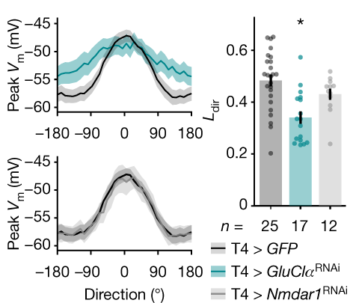
Disinhibition sharpens T4 directional tuning
Mi9 hyperpolarizes when light enters its receptive field. Reduced glutamate release can close GluClα channels and briefly raise T4 resistance before central excitation arrives.
In Groschner and colleagues’ ON-edge experiments, control responses 60° away from the preferred direction averaged 72.97% of the preferred response. GluClα-knockdown responses remained at 89.62%, indicating broader tuning.
The comparison includes GFP controls, GluClα RNAi, and Nmdar1 RNAi controls. The directionality index decreased after GluClα knockdown, with p = 0.0002 for the reported post hoc comparison.
Knockdown also alters resting voltage and resistance. Its effect therefore reflects the complete conductance mechanism, including selective amplification through release from inhibition.
Groschner et al. (2022), Fig. 5C. Control n = 25, GluClα RNAi n = 17, Nmdar1 RNAi n = 12 cells. Ldir: directional tuning index.
Groschner et al. (2022); Takemura et al. (2017)
28
Notes:
Groschner LN, Malis JG, Zuidinga B, Borst A (2022). A biophysical account of multiplication by a single neuron. Nature 603: 119-123. https://doi.org/10.1038/s41586-022-04428-3
Takemura SY, Nern A, Chklovskii DB, Scheffer LK, Rubin GM, Meinertzhagen IA (2017). The comprehensive connectome of a neural substrate for 'ON' motion detection in Drosophila. eLife 6: e24394. https://doi.org/10.7554/elife.24394
Figure credit: Groschner et al. (2022), Fig. 5C. Control n = 25, GluClα RNAi n = 17, Nmdar1 RNAi n = 12 cells. Ldir: directional tuning index.

Slide 29
The OFF pathway has a different input circuit
T5 receives dark-edge information through several transmedullary neurons. Reconstructions place Tm1, Tm2, and Tm4 inputs near the central dendritic region, Tm9 toward the tip, and CT1 toward the base.
This resembles T4’s spatial organization, but transmitter assignments differ. Tm9 supplies cholinergic input to T5, whereas the distal Mi9 input to T4 is glutamatergic.
CT1 is a large GABAergic neuron with repeated local branches. Its broad anatomy does not establish that every branch carries the same global signal.
Similar directional outputs can emerge from circuits with different excitatory sources, inhibitory partners, and postsynaptic receptors. Anatomy constrains these possibilities, while physiological tests determine how the inputs interact.
Shinomiya et al. (2019); Gruntman et al. (2019); Arenz et al. (2017)
29
Notes:
Shinomiya K, Huang G, Lu Z, Parag T, Xu CS, Aniceto R, Ansari N, Cheatham N, Lauchie S, Neace E, Ogundeyi O, Ordish C, Peel D, Shinomiya A, Smith C, Takemura S, Talebi I, Rivlin PK, Nern A, Scheffer LK, Plaza SM, Meinertzhagen IA (2019). Comparisons between the ON- and OFF-edge motion pathways in the Drosophila brain. eLife 8: e40025. https://doi.org/10.7554/elife.40025
Gruntman E, Romani S, Reiser MB (2019). The computation of directional selectivity in the Drosophila OFF motion pathway. eLife 8: e50706. https://doi.org/10.7554/elife.50706
Arenz A, Drews MS, Richter FG, Ammer G, Borst A (2017). The Temporal Tuning of the Drosophila Motion Detectors Is Determined by the Dynamics of Their Input Elements. Current biology : CB 27: 929-944. https://doi.org/10.1016/j.cub.2017.01.051

Slide 30
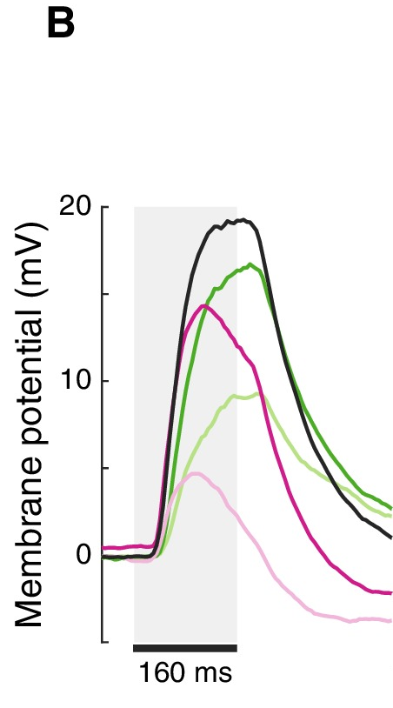
Spatially offset hyperpolarization in T5
Gruntman and colleagues recorded T5 voltage while presenting OFF flashes at mapped positions. Dark bars evoked a central depolarizing field and spatially offset hyperpolarization.
The selected traces compare dynamics across receptive-field positions. Leading-side responses rose and decayed differently from trailing-side responses. These comparisons used 17 cells and 160 ms flashes.
At some positions, hyperpolarization persisted beyond stimulus offset. It could therefore overlap subsequent excitation in a moving sequence and contribute to directional suppression.
Hyperpolarization alone cannot distinguish direct inhibition from withdrawal of excitation. Models using these different mechanisms made distinct predictions for moving bars and gratings. The direct-inhibition model better captured the measured responses.
Gruntman et al. (2019), Fig. 2B. Mean voltage for 160 ms flashes. Green: leading side. Black: center. Pink: trailing side.
Gruntman et al. (2019)
30
Notes:
Gruntman E, Romani S, Reiser MB (2019). The computation of directional selectivity in the Drosophila OFF motion pathway. eLife 8: e50706. https://doi.org/10.7554/elife.50706
Figure credit: Gruntman et al. (2019), Fig. 2B. Mean voltage for 160 ms flashes. Green: leading side. Black: center. Pink: trailing side.

Slide 31
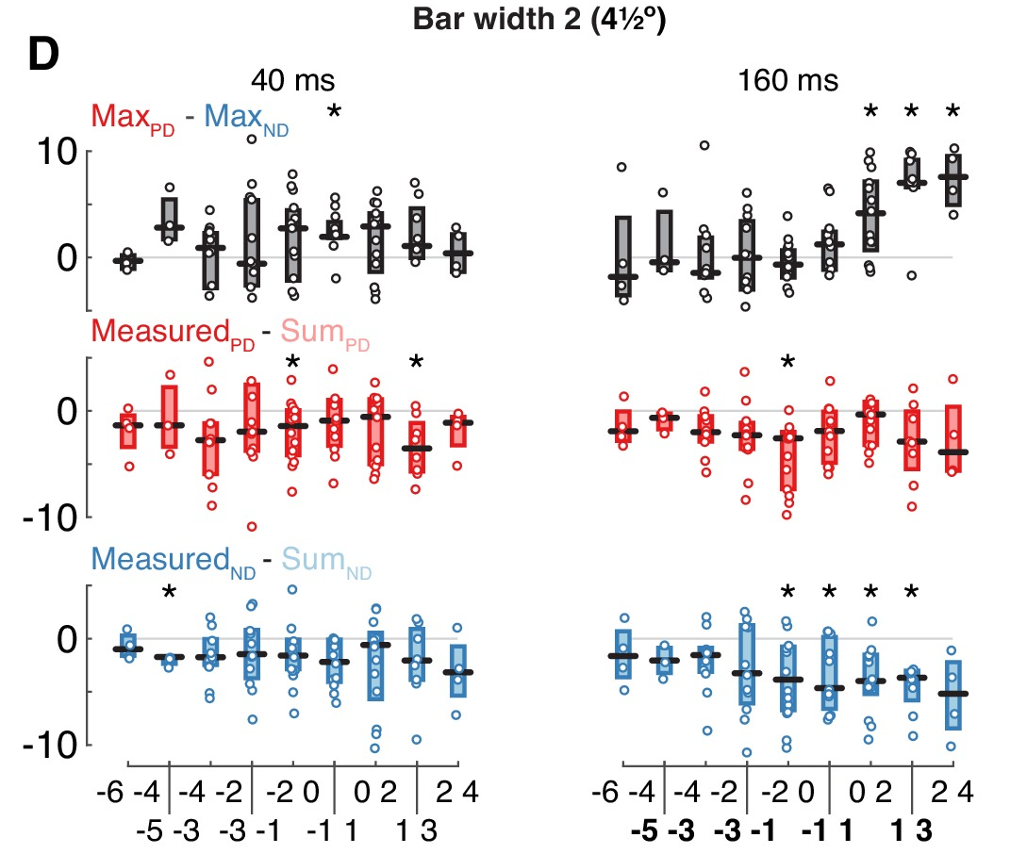
Pairwise OFF flashes test the T5 computation
The investigators compared sequential OFF-flash responses with the time-aligned sum of responses to each component. A response above the sum supports enhancement. A response below it supports suppression.
Across tested positions and durations, the voltage data showed robust null-direction suppression. Preferred-direction responses did not show corresponding systematic enhancement.
The top row quantifies directional differences. The middle and bottom rows measure deviations from linear summation for preferred and null directions. Negative values in the bottom row indicate suppression.
This conclusion concerns the tested T5 voltage responses and stimuli. Calcium measurements or different stimulation regimes can reveal additional nonlinearities, so comparisons require matched measurement levels.
Gruntman et al. (2019), Fig. 3D, 4.5°-wide bars at 40 and 160 ms. Boxplots compare preferred and null directions and deviations from summed responses.
Gruntman et al. (2019); Leong et al. (2016)
31
Notes:
Gruntman E, Romani S, Reiser MB (2019). The computation of directional selectivity in the Drosophila OFF motion pathway. eLife 8: e50706. https://doi.org/10.7554/elife.50706
Leong JC, Esch JJ, Poole B, Ganguli S, Clandinin TR (2016). Direction Selectivity in Drosophila Emerges from Preferred-Direction Enhancement and Null-Direction Suppression. The Journal of neuroscience : the official journal of the Society for Neuroscience 36: 8078-8092. https://doi.org/10.1523/jneurosci.1272-16.2016
Figure credit: Gruntman et al. (2019), Fig. 3D, 4.5°-wide bars at 40 and 160 ms. Boxplots compare preferred and null directions and deviations from summed responses.

Slide 32
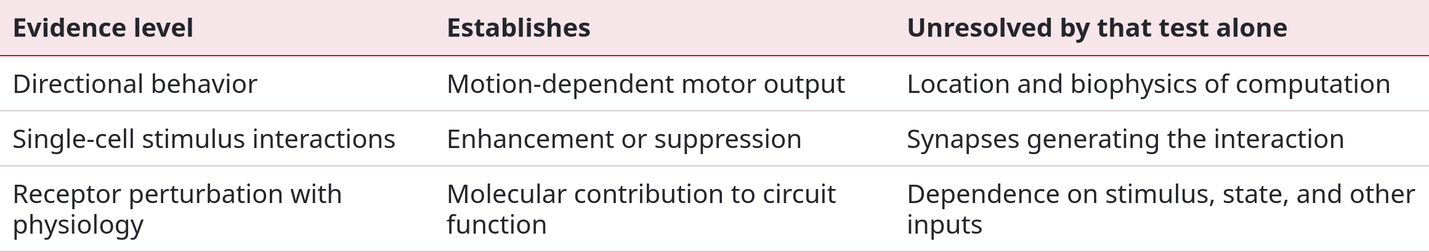
Algorithmic models and biological mechanisms
The Reichardt model emphasizes preferred-direction enhancement through correlation-like interaction. The Barlow–Levick model emphasizes null-direction suppression. Both can generate directional outputs, especially after opponent subtraction.
A final turning response can conceal whether the local circuit enhanced one sequence or suppressed its reverse. Measuring internal signals helps distinguish these accounts.
Fly circuits contain more inputs than the simplest two-branch diagrams. Conductance interactions, rectification, and downstream calcium transformations contribute different nonlinearities.
Leong et al. (2016); Gruntman et al. (2018); Gruntman et al. (2019); Groschner et al. (2022)
32
Notes:
Leong JC, Esch JJ, Poole B, Ganguli S, Clandinin TR (2016). Direction Selectivity in Drosophila Emerges from Preferred-Direction Enhancement and Null-Direction Suppression. The Journal of neuroscience : the official journal of the Society for Neuroscience 36: 8078-8092. https://doi.org/10.1523/jneurosci.1272-16.2016
Gruntman E, Romani S, Reiser MB (2018). Simple integration of fast excitation and offset, delayed inhibition computes directional selectivity in Drosophila. Nature neuroscience 21: 250-257. https://doi.org/10.1038/s41593-017-0046-4
Gruntman E, Romani S, Reiser MB (2019). The computation of directional selectivity in the Drosophila OFF motion pathway. eLife 8: e50706. https://doi.org/10.7554/elife.50706
Groschner LN, Malis JG, Zuidinga B, Borst A (2022). A biophysical account of multiplication by a single neuron. Nature 603: 119-123. https://doi.org/10.1038/s41586-022-04428-3

Slide 33
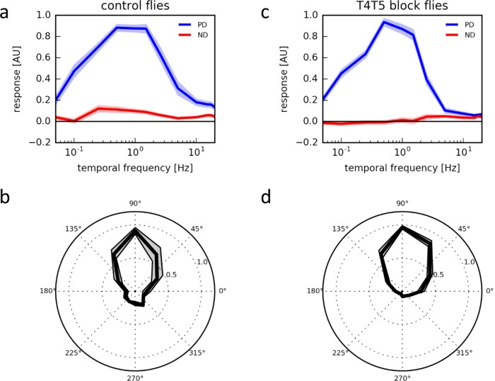
Local direction selectivity survives output blockade
If T4/T5 direction selectivity depended on reciprocal interactions through their outputs, blocking synaptic release should remove that selectivity.
Haag and colleagues expressed tetanus toxin light chain in T4/T5 neurons and measured their calcium responses. Strong preferred-direction tuning remained despite output blockade.
The upper panels compare temporal-frequency tuning, and the lower panels compare direction tuning at 1 Hz. Controls included 15 flies for frequency tuning and seven for direction tuning. Each blocked group included nine flies.
This places the essential local computation upstream of effective T4/T5 output. It argues against a requirement for output-mediated opponent feedback in the tested responses, while leaving room for recurrent effects under other conditions.
Haag et al. (2016), Fig. 6. Calcium responses with intact or blocked output. Mean ± SEM, with separate normalization.
Haag et al. (2016); Takemura et al. (2017)
33
Notes:
Haag J, Arenz A, Serbe E, Gabbiani F, Borst A (2016). Complementary mechanisms create direction selectivity in the fly. eLife 5: e17421. https://doi.org/10.7554/elife.17421
Takemura SY, Nern A, Chklovskii DB, Scheffer LK, Rubin GM, Meinertzhagen IA (2017). The comprehensive connectome of a neural substrate for 'ON' motion detection in Drosophila. eLife 6: e24394. https://doi.org/10.7554/elife.24394
Figure credit: Haag et al. (2016), Fig. 6. Calcium responses with intact or blocked output. Mean ± SEM, with separate normalization.

Slide 34
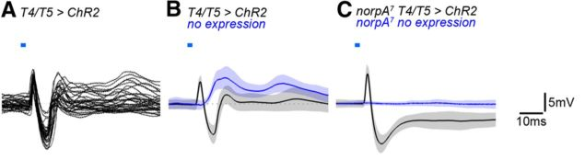
T4/T5 recruit excitation and delayed inhibition
Mauss et al. (2014), Fig. 2A–C, with the shared scale bar from F. Panel C: experimental n = 7, control n = 4 cells.
Mauss and colleagues expressed channelrhodopsin in T4/T5 and recorded from downstream tangential cells. A brief light pulse directly activated the targeted neurons.
Controls lacking channelrhodopsin separated ordinary visual responses from actuator-driven responses. The inhibitory phase follows activation of the targeted T4/T5 population.
A rapid postsynaptic depolarization preceded hyperpolarization. Both components persisted in norpA flies lacking normal phototransduction, supporting transmission through the optogenetic pathway.
Cholinergic T4/T5 output recruits direct excitation and indirect inhibition. A biphasic trace cannot establish release of opposing transmitters by T4/T5. Pharmacology tests the intervening synapses.
Mauss et al. (2014)
34
Notes:
Mauss AS, Meier M, Serbe E, Borst A (2014). Optogenetic and pharmacologic dissection of feedforward inhibition in Drosophila motion vision. The Journal of neuroscience : the official journal of the Society for Neuroscience 34: 2254-2263. https://doi.org/10.1523/jneurosci.3938-13.2014
Figure credit: Mauss et al. (2014), Fig. 2A–C, with the shared scale bar from F. Panel C: experimental n = 7, control n = 4 cells.

Slide 35
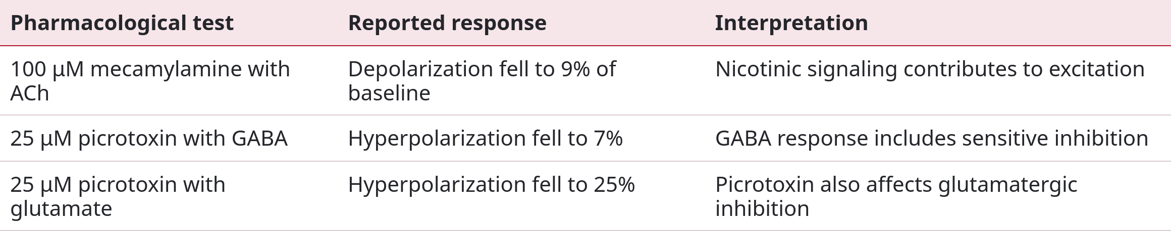
Pharmacology separates synaptic mechanisms
Applied acetylcholine depolarized tangential cells even when low-calcium, high-magnesium saline suppressed network transmission, supporting a direct excitatory action.
The delayed inhibitory response depended on network transmission. Antagonist experiments separated cholinergic excitation from chloride-mediated inhibition.
Picrotoxin reduced both GABA and glutamate responses here. Its effect alone therefore could not identify the inhibitory transmitter. Percentages below refer to normalized response components, rather than receptor occupancy.
Mauss et al. (2014)
35
Notes:
Mauss AS, Meier M, Serbe E, Borst A (2014). Optogenetic and pharmacologic dissection of feedforward inhibition in Drosophila motion vision. The Journal of neuroscience : the official journal of the Society for Neuroscience 34: 2254-2263. https://doi.org/10.1523/jneurosci.3938-13.2014

Slide 36
Lobula plate interneurons implement opponency
Local lobula plate interneurons, called LPi neurons, connect neighboring layers with opposite directional preferences. T4/T5 can excite tangential cells directly while recruiting inhibition of an oppositely tuned pathway.
Mauss and colleagues combined anatomy, molecular characterization, recordings, and manipulation to identify this circuit. The interneurons convey direction-selective inhibition and help reject inappropriate responses to complex motion patterns.
This processing stage follows the generation of direction selectivity in a T4 or T5 dendrite. Local detectors already carry directional information before converging on the opponent circuit.
With competing stimulus directions, the balance of excitatory and inhibitory population activity determines wide-field output. The spatial arrangement helps retain the pattern associated with relevant optic flow.
Mauss et al. (2015); Mauss et al. (2014); Haag et al. (2016)
36
Notes:
Mauss AS, Pankova K, Arenz A, Nern A, Rubin GM, Borst A (2015). Neural Circuit to Integrate Opposing Motions in the Visual Field. Cell 162: 351-362. https://doi.org/10.1016/j.cell.2015.06.035
Mauss AS, Meier M, Serbe E, Borst A (2014). Optogenetic and pharmacologic dissection of feedforward inhibition in Drosophila motion vision. The Journal of neuroscience : the official journal of the Society for Neuroscience 34: 2254-2263. https://doi.org/10.1523/jneurosci.3938-13.2014
Haag J, Arenz A, Serbe E, Gabbiani F, Borst A (2016). Complementary mechanisms create direction selectivity in the fly. eLife 5: e17421. https://doi.org/10.7554/elife.17421

Slide 37
Wide-field integration in HS and VS neurons
Horizontal-system (HS) and vertical-system (VS) neurons extend broad dendrites through the lobula plate. Their receptive fields pool signals from many local motion detectors.
Individual detector responses depend on texture, contrast, and pattern phase. Spatial integration can reduce fluctuations associated with individual features while preserving directional population signals.
Single and Borst measured dendritic calcium and output signals in fly tangential cells. Local dendritic activity retained pattern-dependent modulations, whereas integration reduced these modulations at the output.
Responses still depend on stimulus and circuit state. Spatial weights and the preferred directions of contributing detectors determine which global flow patterns a wide-field cell represents. Anatomy and behavioral intervention establish how those patterns guide movement.
Single & Borst (1998); Haag et al. (2004); Henning et al. (2022)
37
Notes:
Single S, Borst A (1998). Dendritic integration and its role in computing image velocity. Science (New York, N.Y.) 281: 1848-1850. https://doi.org/10.1126/science.281.5384.1848
Haag J, Denk W, Borst A (2004). Fly motion vision is based on Reichardt detectors regardless of the signal-to-noise ratio. Proceedings of the National Academy of Sciences of the United States of America 101: 16333-16338. https://doi.org/10.1073/pnas.0407368101
Henning M, Ramos-Traslosheros G, Gür B, Silies M (2022). Populations of local direction-selective cells encode global motion patterns generated by self-motion. Science advances 8: eabi7112. https://doi.org/10.1126/sciadv.abi7112

Slide 38
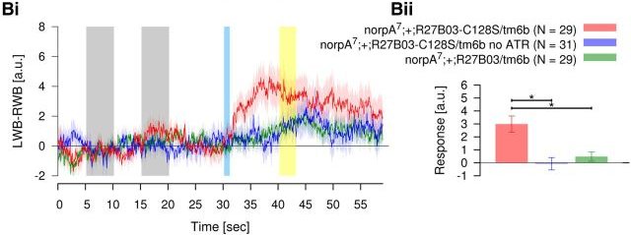
Activating HS neurons produces steering signals
Haikala et al. (2013), Fig. 4B. Blind-fly flight assay, mean ± SEM. LWB–RWB: left minus right wingbeat amplitude. Significant comparisons: p < 0.01.
Haikala and colleagues expressed ChR2-C128S, a long-lasting channelrhodopsin variant, in HS neurons. Blue light opened the channel, and a longer-wavelength pulse terminated its conducting state.
The data compare 29 experimental flies with 31 controls lacking dietary retinal and 29 driver-only controls. Retinal is the actuator’s light-absorbing cofactor.
The measurement is left–right wingbeat difference, a signal related to yaw torque rather than a free-flight trajectory. The experiment supports sufficiency of targeted HS activity for a component of optomotor steering.
In phototransduction-defective norpA flies, unilateral activation produced sustained wingbeat asymmetry despite failure of ordinary visual stimulation. Targeted HS activity can therefore drive steering.
Haikala et al. (2013)
38
Notes:
Haikala V, Joesch M, Borst A, Mauss AS (2013). Optogenetic control of fly optomotor responses. The Journal of neuroscience : the official journal of the Society for Neuroscience 33: 13927-13934. https://doi.org/10.1523/jneurosci.0340-13.2013
Figure credit: Haikala et al. (2013), Fig. 4B. Blind-fly flight assay, mean ± SEM. LWB–RWB: left minus right wingbeat amplitude. Significant comparisons: p < 0.01.

Slide 39
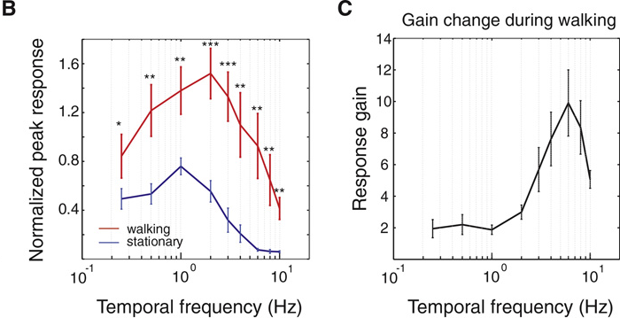
Walking changes visual motion sensitivity
Chiappe et al. (2010), Fig. 4B–C. Mean ± SEM. Gain equals walking response divided by stationary response at the same frequency.
Chiappe and colleagues imaged HSN dendritic calcium while tethered flies walked on a ball. Identical gratings were presented during walking and stationary periods.
Population curves included eight flies at most frequencies and six at 0.25 and 10 Hz. Responses were normalized to each fly’s maximum stationary response. Values above one exceed that reference.
Walking increased response amplitude and shifted tuning toward higher temporal frequencies. The change differed across stimulus frequencies rather than uniformly multiplying every response.
Behavioral state changes the operating range of the motion pathway. A preferred frequency measured at rest cannot automatically describe processing during locomotion. The plotted gain compares states at each stimulus frequency.
Chiappe et al. (2010)
39
Notes:
Chiappe ME, Seelig JD, Reiser MB, Jayaraman V (2010). Walking modulates speed sensitivity in Drosophila motion vision. Current biology : CB 20: 1470-1475. https://doi.org/10.1016/j.cub.2010.06.072
Figure credit: Chiappe et al. (2010), Fig. 4B–C. Mean ± SEM. Gain equals walking response divided by stationary response at the same frequency.

Slide 40
Flight gain and octopaminergic modulation
Maimon and colleagues recorded VS neurons during tethered flight and rest. Peak-to-peak visual responses approximately doubled during flight. Passive resistance decreased, suggesting stronger upstream synaptic drive rather than increased resistance in the recorded cell.
Suver and colleagues tested octopamine, an invertebrate neuromodulator. Applying it to quiescent flies produced an enhancement resembling the flight effect. Optic-lobe-projecting octopamine neurons increased activity during flight.
Genetic activation and suppression showed that these neurons were sufficient and necessary for the measured flight-dependent boost.
Neuromodulation adjusts sensory processing according to behavioral state. These experiments establish an octopaminergic contribution. Identifying each downstream receptor and ionic target requires additional cell-specific evidence.
Maimon et al. (2010); Suver et al. (2012)
40
Notes:
Maimon G, Straw AD, Dickinson MH (2010). Active flight increases the gain of visual motion processing in Drosophila. Nature neuroscience 13: 393-399. https://doi.org/10.1038/nn.2492
Suver MP, Mamiya A, Dickinson MH (2012). Octopamine neurons mediate flight-induced modulation of visual processing in Drosophila. Current biology : CB 22: 2294-2302. https://doi.org/10.1016/j.cub.2012.10.034

Slide 41
Input dynamics determine temporal tuning
Temporal filtering is distributed across presynaptic cell types. Fast transient signals and slower sustained signals interact differently as image speed changes.
Arenz and colleagues measured the spatiotemporal responses of columnar inputs to T4/T5 using two-photon imaging. Their data constrained models combining central, enhancing, and suppressing components.
Activating octopamine receptors shifted T4/T5 tuning toward higher frequencies. The accompanying acceleration of input-neuron dynamics accounted for the shift in their model.
This connects state modulation to timing within the motion computation. The explanation combines measured changes in neuronal dynamics with a model of their consequences. Multiple processing stages contribute delays, and additional cell-specific experiments are needed to assign each effect to particular receptors or ion channels.
Arenz et al. (2017); Suver et al. (2012); Behnia et al. (2014)
41
Notes:
Arenz A, Drews MS, Richter FG, Ammer G, Borst A (2017). The Temporal Tuning of the Drosophila Motion Detectors Is Determined by the Dynamics of Their Input Elements. Current biology : CB 27: 929-944. https://doi.org/10.1016/j.cub.2017.01.051
Suver MP, Mamiya A, Dickinson MH (2012). Octopamine neurons mediate flight-induced modulation of visual processing in Drosophila. Current biology : CB 22: 2294-2302. https://doi.org/10.1016/j.cub.2012.10.034
Behnia R, Clark DA, Carter AG, Clandinin TR, Desplan C (2014). Processing properties of ON and OFF pathways for Drosophila motion detection. Nature 512: 427-430. https://doi.org/10.1038/nature13427

Slide 42
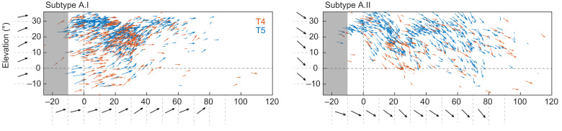
Local direction maps reflect global optic flow
Henning et al. (2022), Fig. 5, layer-A panels. T4 vectors: red. T5 vectors: blue. Measured positions and directions from 14 flies.
Henning and colleagues used perspective-corrected stimuli to map T4/T5 over visual space. They recorded 3,537 units in 14 flies, including 1,376 T4 and 2,161 T5 units.
The dataset supported six functional tuning groups despite four anatomical projection layers. Population patterns matched global flow fields associated with self-motion.
Preference varied systematically with receptive-field location. The displayed layer-A populations differ in diagonal tuning, with additional variation across each map.
The four-cardinal-direction diagram is therefore a local approximation. Optic-flow computation depends on where each detector samples the eye, as well as its projection layer and ON/OFF identity. Local neural diversity contributes to the population representation.
Henning et al. (2022); Maisak et al. (2013)
42
Notes:
Henning M, Ramos-Traslosheros G, Gür B, Silies M (2022). Populations of local direction-selective cells encode global motion patterns generated by self-motion. Science advances 8: eabi7112. https://doi.org/10.1126/sciadv.abi7112
Maisak MS, Haag J, Ammer G, Serbe E, Meier M, Leonhardt A, Schilling T, Bahl A, Rubin GM, Nern A, Dickson BJ, Reiff DF, Hopp E, Borst A (2013). A directional tuning map of Drosophila elementary motion detectors. Nature 500: 212-216. https://doi.org/10.1038/nature12320
Figure credit: Henning et al. (2022), Fig. 5, layer-A panels. T4 vectors: red. T5 vectors: blue. Measured positions and directions from 14 flies.

Slide 43
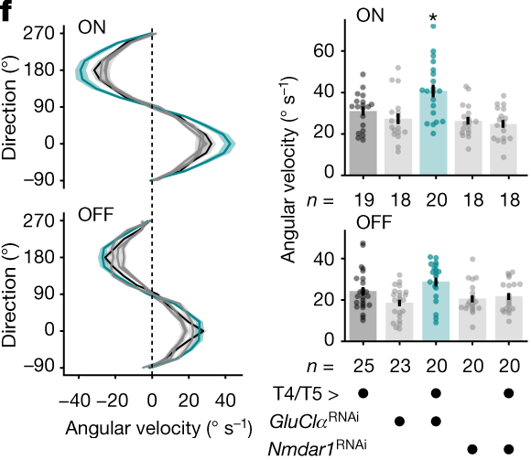
Motion stabilization and object fixation
Fixation keeps an object near a selected retinal position. It uses position information as well as motion, allowing performance to differ from panorama-driven turning.
Bahl and colleagues blocked T4/T5 and observed loss of the optomotor response, while black-bar fixation persisted with reduced performance. A parallel position-sensitive circuit supported part of fixation.
Groschner and colleagues instead altered GluClα signaling. Walking responses increased selectively for moving ON edges, consistent with broader tuning. OFF edges provided a polarity comparison.
Complete pathway blockade and altered tuning produce different outcomes. Behavioral performance depends on the information represented by a population, its downstream readout, and other visual pathways available to support the task.
Groschner et al. (2022), Fig. 5F, curves and group comparisons placed side by side. Experimental n = 20 flies. Parental and Nmdar1 RNAi controls included.
Bahl et al. (2013); Groschner et al. (2022)
43
Notes:
Bahl A, Ammer G, Schilling T, Borst A (2013). Object tracking in motion-blind flies. Nature neuroscience 16: 730-738. https://doi.org/10.1038/nn.3386
Groschner LN, Malis JG, Zuidinga B, Borst A (2022). A biophysical account of multiplication by a single neuron. Nature 603: 119-123. https://doi.org/10.1038/s41586-022-04428-3
Figure credit: Groschner et al. (2022), Fig. 5F, curves and group comparisons placed side by side. Experimental n = 20 flies. Parental and Nmdar1 RNAi controls included.

Slide 44
Key takeaways
Optomotor behavior uses retinal slip as feedback. Local signals influence head movement, walking turns, and flight steering. Tethered assays measure attempted movement, while closed-loop performance also depends on feedback dynamics.
Synaptic conductances implement the computation. Spatially offset excitation and inhibition shape tuning. GluClα-dependent shunting and release from inhibition provide a demonstrated molecular contribution to T4 selectivity.
The Reichardt detector compares space across time. Asymmetric filtering and nonlinear interaction favor a particular sequence. Opponent subtraction creates a signed signal. Spatial wavelength and contrast also influence output.
Causal evidence requires appropriate comparisons. Flicker responses, genetic controls, single-flash sums, receptor perturbations, and optogenetic controls connect specific mechanisms to neuronal activity and measured behavior.
T4 and T5 separate ON and OFF motion. Inputs differ in timing and synaptic sign. Matching direction preferences converge in lobula plate layers for wide-field integration.
Motion processing depends on spatial context and state. Preference varies across the eye, and locomotion changes gain and timing. Object fixation can recruit pathways that remain functional after motion-channel blockade.
Hassenstein & Reichardt (1956); Maisak et al. (2013); Groschner et al. (2022); Mauss et al. (2015); Henning et al. (2022)
44
Notes:
Hassenstein B, Reichardt W (1956). Systemtheoretische Analyse der Zeit-, Reihenfolgen- und Vorzeichenauswertung bei der Bewegungsperzeption des Rüsselkäfers Chlorophanus. Zeitschrift für Naturforschung B 11: 513–524. https://doi.org/10.1515/znb-1956-9-1004
Maisak MS, Haag J, Ammer G, Serbe E, Meier M, Leonhardt A, Schilling T, Bahl A, Rubin GM, Nern A, Dickson BJ, Reiff DF, Hopp E, Borst A (2013). A directional tuning map of Drosophila elementary motion detectors. Nature 500: 212-216. https://doi.org/10.1038/nature12320
Groschner LN, Malis JG, Zuidinga B, Borst A (2022). A biophysical account of multiplication by a single neuron. Nature 603: 119-123. https://doi.org/10.1038/s41586-022-04428-3
Mauss AS, Pankova K, Arenz A, Nern A, Rubin GM, Borst A (2015). Neural Circuit to Integrate Opposing Motions in the Visual Field. Cell 162: 351-362. https://doi.org/10.1016/j.cell.2015.06.035
Henning M, Ramos-Traslosheros G, Gür B, Silies M (2022). Populations of local direction-selective cells encode global motion patterns generated by self-motion. Science advances 8: eabi7112. https://doi.org/10.1126/sciadv.abi7112

