Slide 1
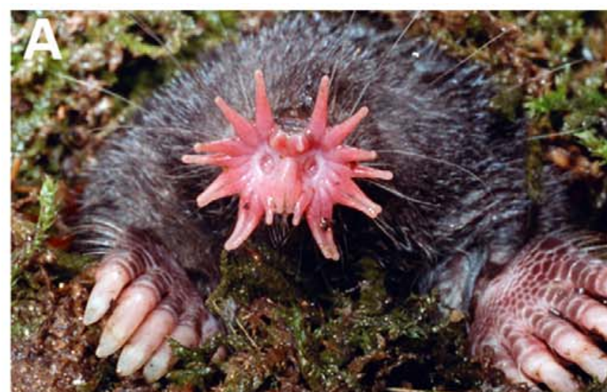
NEUR 411 · NEUROETHOLOGY · FALL 2026
Lecture 26
Tactile specialization: the star-nosed mole's tactile fovea (Catania)
Monday, October 26, 2026
Jordan Lopez, Ph.D.
Professor of Neurobiology & Biomedical Engineering
Gerhold et al. (2013), Fig. 1(A). Star-nosed mole with the expanded tactile star.
Notes:
Tactile specialization: the star-nosed mole's tactile fovea (Catania)
Lecture 26. NEUR 411 · NEUROETHOLOGY · FALL 2026. Monday, October 26, 2026.
Figure: Gerhold et al. (2013), Fig. 1(A). Star-nosed mole with the expanded tactile star.
Figure source: https://doi.org/10.1371/journal.pone.0055001
• The star-nosed mole uses 22 nasal rays to sample surfaces. Initial contacts recruit a broad sensory sheet; prey-directed movements bring the eleventh ray pair onto the target. The photograph is Gerhold et al. (2013), Figure 1A.
References:
Gerhold KA, Pellegrino M, Tsunozaki M, Morita T, Leitch DB, Tsuruda PR, Brem RB, Catania KC, Bautista DM (2013). The Star-Nosed Mole Reveals Clues to the Molecular Basis of Mammalian Touch. PLoS ONE 8(1):e55001. https://doi.org/10.1371/journal.pone.0055001
Catania KC, Kaas JH (1997). Somatosensory fovea in the star-nosed mole: Behavioral use of the star in relation to innervation patterns and cortical representation. The Journal of Comparative Neurology 387(2):215-233. https://doi.org/10.1002/(sici)1096-9861(19971020)387:2<215::aid-cne4>3.0.co;2-3

Slide 2
The star is a tactile surface for finding small prey
The star-nosed mole, Condylura cristata, searches wetland substrates with 22 fleshy nasal rays. Tactile sensing detects mechanical contact rather than airborne chemicals, so the rays work as touch surfaces that meet the environment directly, rather than as fingers that grasp food. Eleven rays surround each nostril, and matching ray numbers on the two sides describe corresponding positions.
Catania and Kaas filmed captive animals from beneath transparent tunnel floors and scored which rays touched earthworm pieces. Filming from below made each contact visible. Contact first spread across the whole star, and later exploration concentrated on the paired ventral eleventh rays, placed just in front of the mouth. The scored contacts form the basis of the ray-use record.
This directed sampling is a behavioral specialization within a single sensory surface. The star supplies broad initial coverage, while a small region repeatedly inspects potential prey, so one organ serves both wide search and close examination. Uniform sampling of the whole star would look different, so the choice of where to sample is part of the specialization.
Gerhold et al. (2013), Fig. 1(A). Star-nosed mole with the expanded tactile star.
Gerhold et al. (2013); Catania & Kaas (1997)
02
Notes:
• The star-nosed mole, Condylura cristata, searches wetland substrates using 22 fleshy nasal rays. Tactile sensing means detecting mechanical contact rather than detecting airborne chemicals. The rays contact surrounding surfaces; they do not function as fingers that grasp food.
– The term ray refers to one fleshy appendage surrounding a nostril. Eleven rays surround each nostril; matching ray numbers on the two sides describe corresponding positions.
• Catania and Kaas filmed captive animals from beneath transparent tunnel floors and scored which rays touched earthworm pieces. Contact initially occurred across the star, but subsequent exploration concentrated on the paired ventral eleventh rays, immediately in front of the mouth.
• This directed sampling establishes a behavioral specialization within one sensory surface. The star provides broad initial coverage while a small region repeatedly inspects potential prey. Observations of normal behavior alone cannot identify the receptors or brain pathways necessary for selecting that region.
References:
Gerhold KA, Pellegrino M, Tsunozaki M, Morita T, Leitch DB, Tsuruda PR, Brem RB, Catania KC, Bautista DM (2013). The Star-Nosed Mole Reveals Clues to the Molecular Basis of Mammalian Touch. PLoS ONE 8(1):e55001. https://doi.org/10.1371/journal.pone.0055001
Catania KC, Kaas JH (1997). Somatosensory fovea in the star-nosed mole: Behavioral use of the star in relation to innervation patterns and cortical representation. The Journal of Comparative Neurology 387(2):215-233. https://doi.org/10.1002/(sici)1096-9861(19971020)387:2<215::aid-cne4>3.0.co;2-3
Figure: Gerhold et al. (2013), Fig. 1(A). Star-nosed mole with the expanded tactile star.
Figure source: https://doi.org/10.1371/journal.pone.0055001

Slide 3
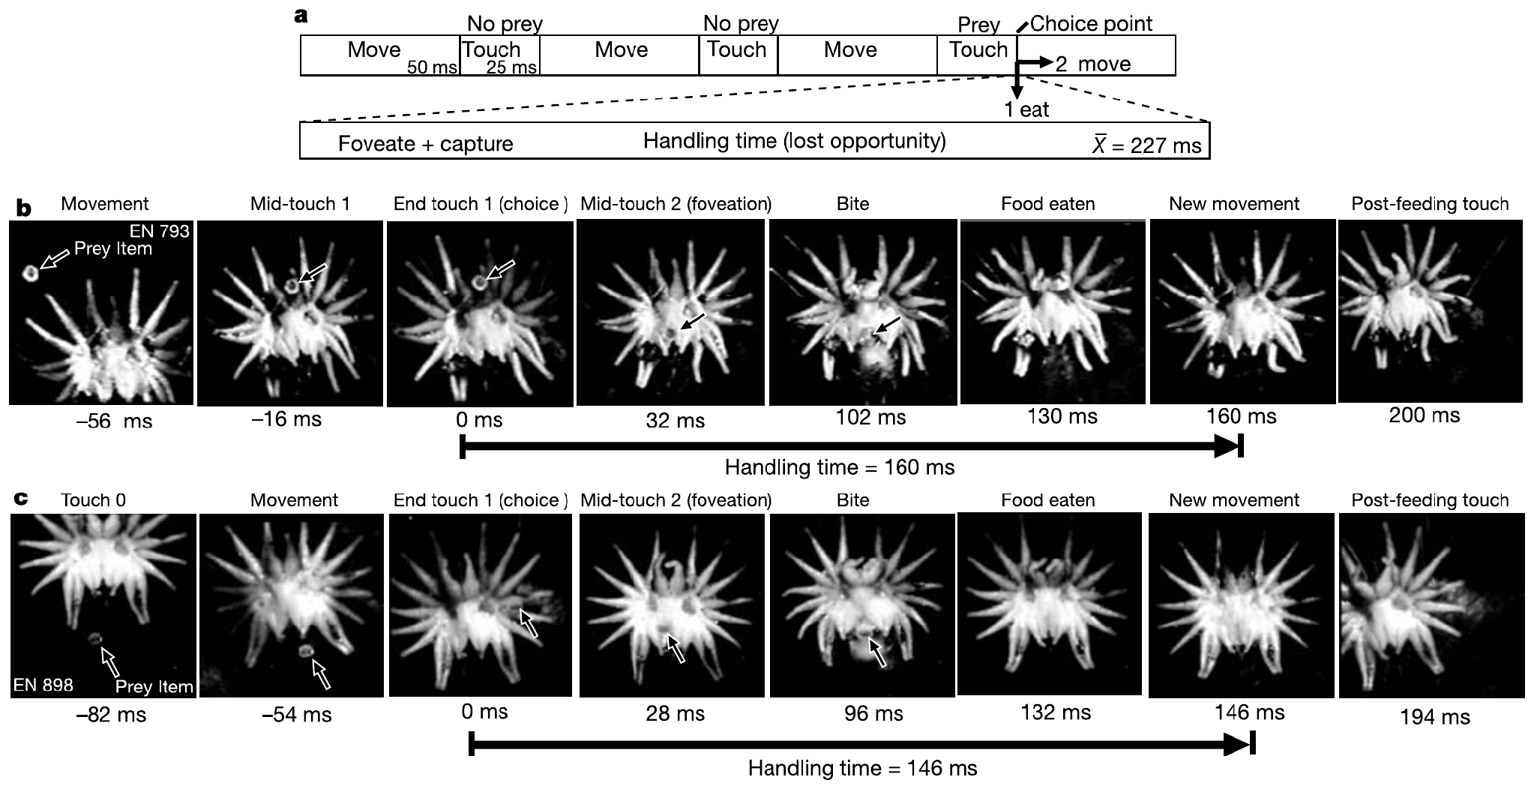
Brief touches alternate with rapid searching movements
Catania and Remple recorded feeding through a glass-bottom tunnel at 500 frames per second. This high-speed videography separated periods of substrate contact from movements between contacts, while the transparent floor kept the star in clear view. Frames at this rate resolve contacts lasting a few tens of milliseconds, so brief touches become countable events.
Search movements lasted about 50 ms and touches about 25 ms, producing approximately 13 contacts per second. A contact could start feeding or lead into another searching movement, so intermittent sampling continues even when the animal appears to explore without pause. The alternation of touch and search is the basic rhythm of the feeding sequence.
Earthworm fragments supplied the prey in these recordings, so each encounter is a short sequence of brief contacts. The searching and touching pattern shows how the star gathers information in small, repeated samples. Each sample is short, so the star relies on many successive contacts rather than one prolonged touch. Each brief touch is therefore a sampling event.
Catania & Remple (2005), Fig. 1(a–c). Published search timing and high-speed prey-capture sequences.
Catania & Remple (2005)
03
Notes:
• Catania and Remple recorded feeding through a glass-bottom tunnel at 500 frames per second. This high-speed videography separated periods of substrate contact from movements between contacts. Earthworm fragments supplied prey while the transparent floor preserved a clear view of the star.
– At 500 frames per second, consecutive recorded frames are separated by 2 ms. The time labels in the published sequence are measurements of behavior, not spike times.
• Search movements lasted about 50 ms and touches about 25 ms, producing approximately 13 contacts per second. A contact could initiate feeding or be followed by another searching movement. Thus sensory sampling is intermittent even though the animal appears to explore continuously.
• The timing describes the recorded laboratory search sequence, rather than a fixed rate under every natural condition. It constrains the time available for extracting information during each encounter but does not identify the neuronal decision or establish that cortical processing ends when contact ends.
References:
Catania KC, Remple FE (2005). Asymptotic prey profitability drives star-nosed moles to the foraging speed limit. Nature 433(7025):519-522. https://doi.org/10.1038/nature03250
Figure: Catania & Remple (2005), Fig. 1(a–c). Published search timing and high-speed prey-capture sequences.
Figure source: https://doi.org/10.1038/nature03250

Slide 4
Frame spacing sets the timing resolution
At 500 frames per second, consecutive frames in these recordings are 2 ms apart. The published time labels are measurements of behavior, not spike times recorded from neurons. Catania and Remple's figure 1(b) reports original frame times for one prey capture followed by renewed search. Catania and Kaas's earlier video used 30 frames per second, a coarser resolution of 33 ms per frame.
The measured timing describes a laboratory search sequence, not a fixed rate under every natural condition. Feeding sessions used earthworm fragments as prey, and a contact may start feeding or be followed by another searching movement. Searching and touching alternate throughout each feeding bout.
The timing constrains the time available for extracting information during each encounter. The published timing leaves the neuronal decision unidentified. Whether cortical processing ends when contact ends requires a separate measurement. Events shorter than one 2 ms frame interval fall below the resolution of these time labels.
Catania & Remple (2005), Fig. 1(a–c). Published search timing and high-speed prey-capture sequences.
Catania & Remple (2005)
03a
Notes:
• Frame spacing sets the timing resolution.
• Explanation 1.
– At 500 frames per second, consecutive frames in these recordings are 2 ms apart
– The published time labels are measurements of behavior, not spike times recorded from neurons. Catania and Remple's figure 1(b) reports original frame times for one prey capture followed by renewed search. Catania and Kaas's earlier video used 30 frames per second, a coarser resolution of 33 ms per frame.
• Explanation 2.
– The measured timing describes a laboratory search sequence, not a fixed rate under every natural condition
– Feeding sessions used earthworm fragments as prey, and a contact may start feeding or be followed by another searching movement. Searching and touching alternate throughout each feeding bout.
• Explanation 3.
– The timing constrains the time available for extracting information during each encounter
– The published timing leaves the neuronal decision unidentified. Whether cortical processing ends when contact ends requires a separate measurement. Events shorter than one 2 ms frame interval fall below the resolution of these time labels.
• Source.
– The figure and the measurements come from Catania & Remple (2005).
– Each statement is tied to the recordings or observations of that study.
References:
Catania KC, Remple FE (2005). Asymptotic prey profitability drives star-nosed moles to the foraging speed limit. Nature 433(7025):519-522. https://doi.org/10.1038/nature03250

Slide 5
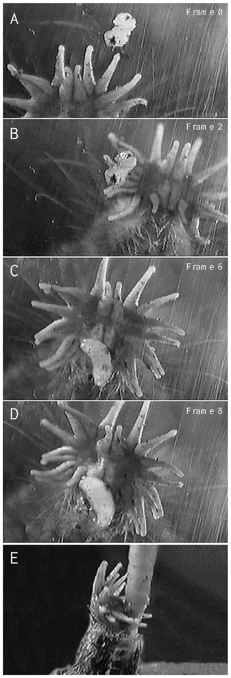
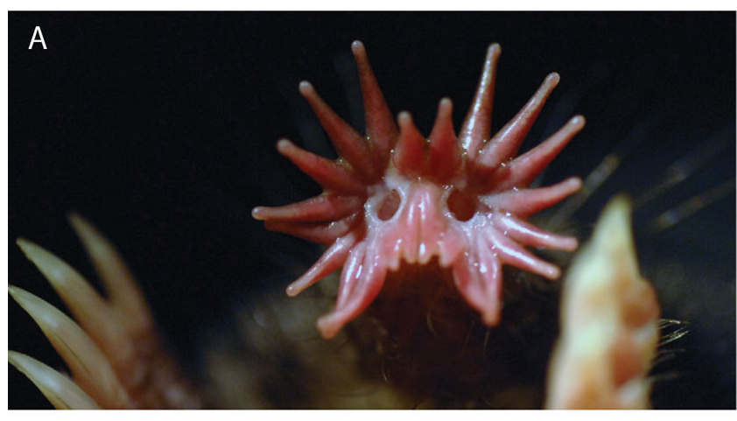
Prey contact redirects the star toward ray 11
Foveation is movement that places a region of high sensory resolution onto a target. Catania and Kaas scored successive contacts in video recordings of feeding, and the initial contact could involve a lateral ray. The recorded contacts show the star moving to bring a target into the region of highest resolution, which is the defining feature of foveation.
Later contacts brought the prey toward the paired eleventh rays. In individual encounters the entire star changed position until ray 11 touched the item, so the sensory surface itself is actively positioned around the target. The movement is a whole-organ reorientation, not a change in the way one ray moves alone. Each later contact moves the item closer to those rays.
Repeated use of ray 11 justifies calling it a tactile fovea. Its behavior resembles target-directed visual fixation, which makes the tactile fovea a close analogue of the visual system's aiming of the eyes at objects. Both systems place the most sensitive region onto what matters most at that moment. Its function therefore resembles fixation.
Sawyer & Catania (2016), Fig. 1(A). The 22-ray tactile star.
Catania & Kaas (1997), Fig. 4(A–E). Original video frames of prey contact and repositioning of ray 11.
Catania & Kaas (1997); Sawyer & Catania (2016)
04
Notes:
• Foveation is movement that places a region of high sensory resolution onto a target. Catania and Kaas scored successive contacts in video recordings of feeding. The initial contact could involve a lateral ray; later contacts brought the prey toward the paired eleventh rays.
– A fovea is defined by preferential, high-resolution sampling, not merely by occupying the center of an organ. The mole moves its entire nasal star to align this ventral region with prey.
• The original recordings used 30 frames per second, so frame numbers identify successive observations rather than millisecond-precise neural events. In individual encounters, the entire star changed position until ray 11 contacted the item. This is active positioning of a sensory surface.
• The repeated use of ray 11 justifies calling it a tactile fovea. Its behavior resembles target-directed visual fixation, but resemblance does not establish identical visual and tactile circuitry. The observations also distinguish sensory inspection by the star from the subsequent grasping action of the teeth.
References:
Catania KC, Kaas JH (1997). Somatosensory fovea in the star-nosed mole: Behavioral use of the star in relation to innervation patterns and cortical representation. The Journal of Comparative Neurology 387(2):215-233. https://doi.org/10.1002/(sici)1096-9861(19971020)387:2<215::aid-cne4>3.0.co;2-3
Sawyer EK, Catania KC (2016). Somatosensory organ topography across the star of the star‐nosed mole (Condylura cristata). Journal of Comparative Neurology 524(5):917-929. https://doi.org/10.1002/cne.23943
Figure: Catania & Kaas (1997), Fig. 4(A–E). Original video frames of prey contact and repositioning of ray 11.
Figure source: https://doi.org/10.1002/(sici)1096-9861(19971020)387:2<215::aid-cne4>3.0.co;2-3
Figure: Sawyer & Catania (2016), Fig. 1(A). The 22-ray tactile star.
Figure source: https://doi.org/10.1002/cne.23943

Slide 6
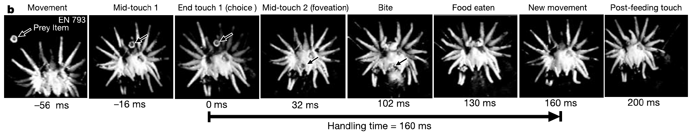
Tiny prey can be identified and eaten within 120 ms
Handling time is the foraging time lost while a predator takes a prey item instead of searching for another. Catania and Remple measured it from the end of the first prey contact until eating finished and the star began another searching movement. This endpoint is set by the resumption of searching, so every trial is timed the same way.
For earthworm pieces 0.8–2.0 mm across, mean handling time was 227 ms, and observed times ranged from 120 to 440 ms. The measured interval included foveation, grasping and consumption, so it spans more than a sensory latency alone. The full sequence of positioning and eating is therefore included in the time. Every trial uses the same endpoints.
These exceptionally short intervals establish rapid performance for small, prepared prey in laboratory conditions. Large prey, environmental obstacles and unsuccessful encounters add other costs, so the 120 ms value describes one well-defined case. Small fragments are the case in which the whole capture sequence stays fast. The sequence ends when the star resumes searching.
Catania & Remple (2005), Fig. 1(b). Prey capture followed by renewed search; original frame times.
Catania & Remple (2005)
05
Notes:
• Handling time is the foraging time lost while taking a prey item instead of searching for another. Catania and Remple measured it from the end of the first prey contact until eating finished and the star began another searching movement.
– The end of handling is defined behaviorally by resumed searching. Using the same endpoint across trials prevents a comparison of swallowing in one trial with first tooth contact in another.
• For earthworm pieces 0.8–2.0 mm across, mean handling time was 227 ms and observed times ranged from 120 to 440 ms. The measured interval included foveation, grasping and consumption. It therefore exceeds a sensory latency and cannot be interpreted as perception time alone.
• These exceptionally short intervals establish rapid performance for small, prepared prey under laboratory conditions. Large prey, environmental obstacles and unsuccessful encounters impose other costs. The experiment does not show that every natural prey item is consumed in 120 ms or that a single neuron controls the whole sequence.
References:
Catania KC, Remple FE (2005). Asymptotic prey profitability drives star-nosed moles to the foraging speed limit. Nature 433(7025):519-522. https://doi.org/10.1038/nature03250
Figure: Catania & Remple (2005), Fig. 1(b). Prey capture followed by renewed search; original frame times.
Figure source: https://doi.org/10.1038/nature03250

Slide 7
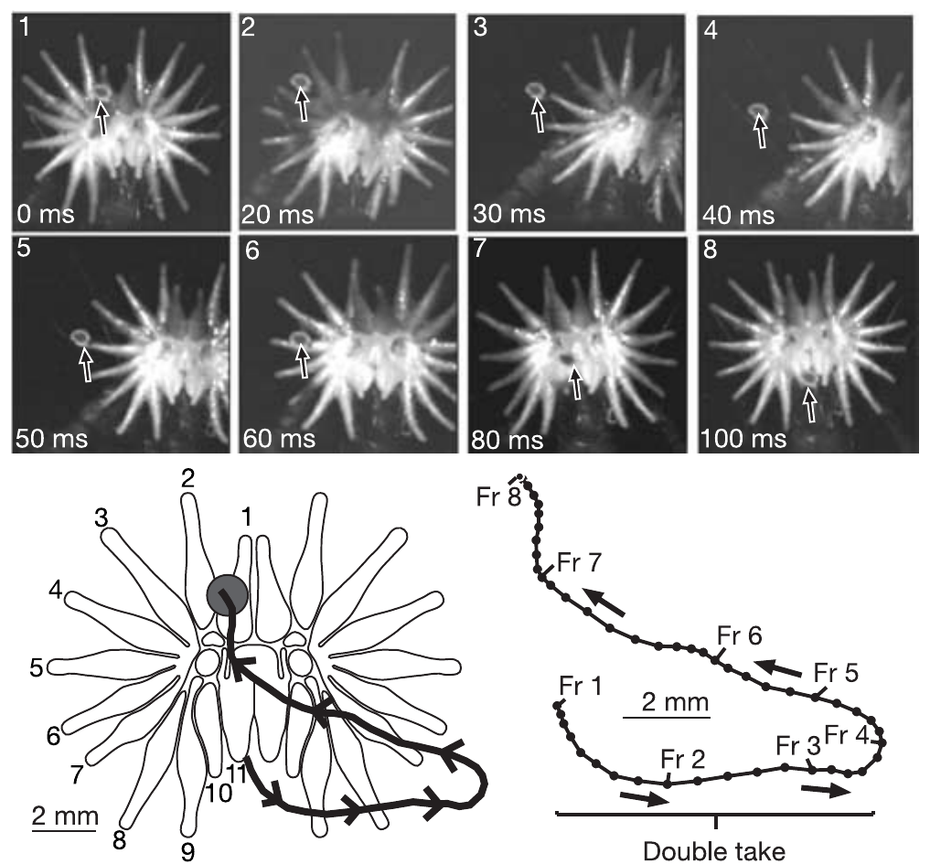
A double take exposes a delay in the feeding decision
In a double take, the star first moves away from a contacted prey item, then reverses and places the fovea onto it. Catania and Remple identified these sequences in high-speed video and followed the prey position across consecutive frames. The frame-by-frame record keeps the timing of the first movement and of the correction in view.
Double takes occurred in more than one-third of feeding trials. A typical contact lasted about 25 ms, whereas prior cortical recordings placed tactile response onset near 12 ms, and the authors estimated about 5 ms for a motor command to reach the periphery. These three intervals were set side by side in the authors' timing argument.
These timings support the proposal that fast sampling sometimes outruns the completed feeding decision. The motor estimate came from the authors' calculation rather than a direct measurement during these encounters. A processing-speed limit is therefore an interpretation of converging evidence from several sources. The timing values come from separate sets of measurements.
Catania & Remple (2005), Fig. 4. Initial movement away from prey followed by a corrective foveation.
Catania & Remple (2005); Sachdev & Catania (2002)
06
Notes:
• In a double take, the star initially moves away from a contacted prey item, then reverses and places the fovea onto it. Catania and Remple identified these sequences in high-speed video, preserving the time course and prey position across consecutive frames.
– A mistaken initial movement lengthens handling without implying that the animal permanently misidentified the prey. The correction indicates that useful tactile information can continue to affect movement after the first response starts.
• Double takes occurred in more than one-third of their feeding trials. A typical contact lasted about 25 ms, whereas prior cortical recordings placed tactile response onset near 12 ms. The authors additionally estimated about 5 ms for a motor command to reach the periphery.
• These timings support their proposal that fast sampling sometimes outruns the completed feeding decision. The motor estimate was not a direct measurement during these encounters, and the video does not prove that cortex causes the reversal. A processing-speed limit is an interpretation of converging evidence.
References:
Catania KC, Remple FE (2005). Asymptotic prey profitability drives star-nosed moles to the foraging speed limit. Nature 433(7025):519-522. https://doi.org/10.1038/nature03250
Sachdev RNS, Catania KC (2002). Receptive Fields and Response Properties of Neurons in the Star-Nosed Mole's Somatosensory Fovea. Journal of Neurophysiology 87(5):2602-2611. https://doi.org/10.1152/jn.2002.87.5.2602
Figure: Catania & Remple (2005), Fig. 4. Initial movement away from prey followed by a corrective foveation.
Figure source: https://doi.org/10.1038/nature03250

Slide 8
Corrective contact continues during movement
A mistaken initial movement lengthens handling. Figure 4 of the study shows the star moving away from prey and then making a corrective foveation, and both movements occur inside one feeding episode. The error lengthens handling, and it is interpreted as a movement error rather than a permanent misidentification of the prey.
The correction indicates that useful tactile information can continue to affect movement after the first response starts. The reversal returns the fovea to the same prey item, so the first contact and the correction belong to one feeding episode, which the video records frame by frame.
The video leaves open whether cortex causes the reversal. The motor estimate was calculated in these encounters rather than observed, and the link between cortex and the reversal remains an inference from the timing values. The timing values come from three separate sets of measurements: a typical contact, prior cortical recordings and a motor estimate.
Catania & Remple (2005), Fig. 4. Initial movement away from prey followed by a corrective foveation.
Catania & Remple (2005)
06a
Notes:
• Corrective contact continues during movement.
• Explanation 1.
– A mistaken initial movement lengthens handling
– Figure 4 of the study shows the star moving away from prey and then making a corrective foveation, and both movements occur inside one feeding episode. The error lengthens handling, and it is interpreted as a movement error rather than a permanent misidentification of the prey.
• Explanation 2.
– The correction indicates that useful tactile information can continue to affect movement after the first response starts
– The reversal returns the fovea to the same prey item, so the first contact and the correction belong to one feeding episode, which the video records frame by frame.
• Explanation 3.
– The video leaves open whether cortex causes the reversal
– The motor estimate was calculated in these encounters rather than observed, and the link between cortex and the reversal remains an inference from the timing values. The timing values come from three separate sets of measurements: a typical contact, prior cortical recordings and a motor estimate.
• Source.
– The figure and the measurements come from Catania & Remple (2005).
– Each statement is tied to the recordings or observations of that study.
References:
Catania KC, Remple FE (2005). Asymptotic prey profitability drives star-nosed moles to the foraging speed limit. Nature 433(7025):519-522. https://doi.org/10.1038/nature03250

Slide 9
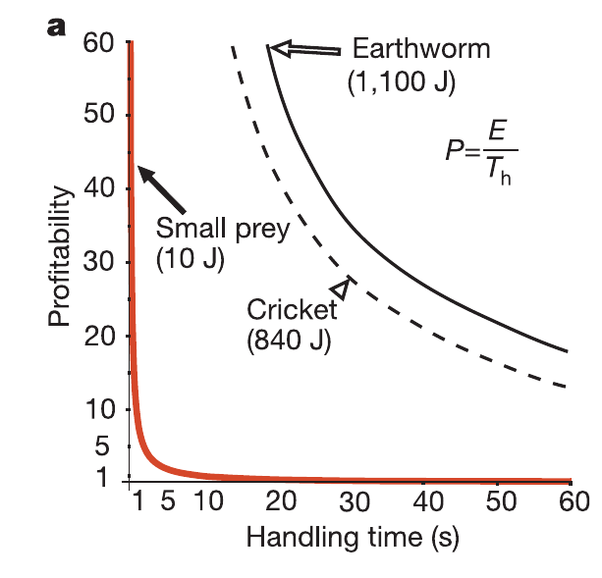
Short handling times make tiny prey profitable
Prey profitability is energy gained per unit handling time. Catania and Remple combined video measurements with published energetic estimates to evaluate small earthworm pieces, and their curves are the authors' published model. Profitability ranks prey by how much energy each item returns for every second spent handling it. The curves are shown as the authors modeled them.
A typical small fragment supplied about 10 J, with handling near 230 ms, giving a reported profitability near 44 J/s. Larger earthworm segments supplied about 1,100 J but took approximately 19 s to handle, which reduced their advantage. The larger segment carries far more energy, yet its long handling time lowers the return per second.
Rapid handling can therefore make tiny prey valuable even when individual items contain little energy. The energetic values were estimates rather than direct calorimetry in each trial, and profitability leaves out search costs. Those costs decide how often a small item is encountered, which is a separate factor from its return. A small fragment can therefore be worth handling.
Catania & Remple (2005), Fig. 2(a). Published prey profitability curves and measured handling-time examples.
Catania & Remple (2005)
07
Notes:
• Prey profitability is energy gained per unit handling time. Catania and Remple combined video measurements with published energetic estimates to evaluate small earthworm pieces. Their original figure compares predicted profitability with measured handling times; its curves are the authors’ published model.
– The red curve is retained exactly as published. Its continuous shape is a theoretical relationship; the feeding durations associated with the animal are separate empirical measurements.
• A typical small fragment supplied approximately 10 J, with handling near 230 ms. The authors reported profitability near 44 J/s. Larger earthworm segments supplied about 1,100 J but took approximately 19 s to handle, reducing the advantage of their greater energy content.
• Rapid handling can therefore make tiny prey valuable even when individual items contain little energy. The energetic values were estimates rather than direct calorimetry in each feeding trial. Profitability also excludes search costs, so it alone cannot establish the preferred diet across different prey densities.
References:
Catania KC, Remple FE (2005). Asymptotic prey profitability drives star-nosed moles to the foraging speed limit. Nature 433(7025):519-522. https://doi.org/10.1038/nature03250
Figure: Catania & Remple (2005), Fig. 2(a). Published prey profitability curves and measured handling-time examples.
Figure source: https://doi.org/10.1038/nature03250

Slide 10
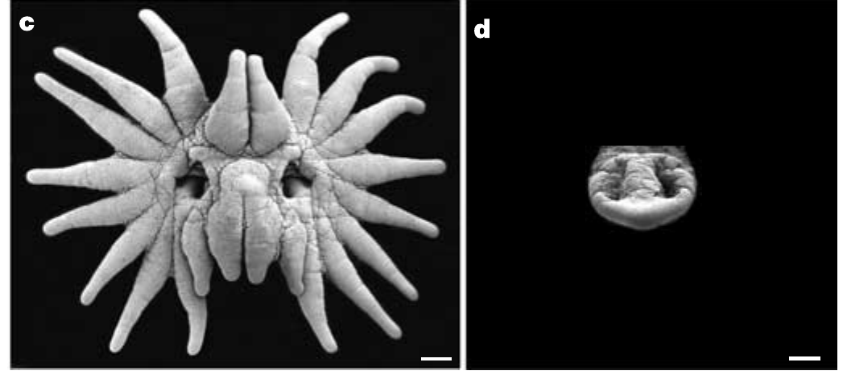
A larger receptor sheet increases sampled area
Catania and Remple measured the contact surface from close-up behavioral recordings and set star-nosed moles beside eastern moles, Scalopus aquaticus. Sensory coverage here means the area touched during one sampling event, rather than the sensitivity of an individual receptor. The measurement therefore concerns how much surface a single touch covers. Coverage is distinct from receptor density.
The star contacted about 0.92 cm² per touch, while the eastern mole's snout contacted 0.11 cm². Search rates were about 13 and eight contacts per second, respectively, and combining coverage with rate predicted roughly fourteenfold greater encounter opportunity at equal small-prey density. Both factors together raise the chance of meeting prey in one encounter.
This link between expanded anatomy and search advantage is plausible rather than measured. The encounter estimate assumes equivalent prey distributions and independent sampling, and eastern moles also ate none of the smallest items accepted by star-nosed moles. The eastern mole therefore serves as a reference point for the star's search performance. Eastern moles set the baseline.
Catania & Remple (2005), Fig. 3(c–d). Star-nosed and eastern mole receptor surfaces; 1-mm scale bars.
Sawyer & Catania (2016), Fig. 1(A). The 22-ray tactile star.
Catania & Remple (2005); Sawyer & Catania (2016)
08
Notes:
• Catania and Remple measured the contact surface from close-up behavioral recordings and compared star-nosed moles with eastern moles, Scalopus aquaticus. Sensory coverage refers here to the area touched during one sampling event, rather than the sensitivity of an individual receptor.
– Area per touch and the number of touches per second affect encounter opportunity independently. A dense receptor array cannot compensate for failing to bring the sensory surface into contact with an item.
• The star contacted approximately 0.92 cm² per touch, compared with 0.11 cm² for the eastern mole’s snout. Search rates were about 13 and eight contacts per second, respectively. Combining coverage and rate predicted roughly fourteenfold greater encounter opportunity at equal small-prey density.
• This comparison links expanded anatomy to a plausible search advantage. The encounter estimate assumes equivalent distributions and independent sampling; it was not a measured fourteenfold increase in captured prey. Eastern moles also did not eat the smallest items accepted by star-nosed moles.
References:
Catania KC, Remple FE (2005). Asymptotic prey profitability drives star-nosed moles to the foraging speed limit. Nature 433(7025):519-522. https://doi.org/10.1038/nature03250
Sawyer EK, Catania KC (2016). Somatosensory organ topography across the star of the star‐nosed mole (Condylura cristata). Journal of Comparative Neurology 524(5):917-929. https://doi.org/10.1002/cne.23943
Figure: Catania & Remple (2005), Fig. 3(c–d). Star-nosed and eastern mole receptor surfaces; 1-mm scale bars.
Figure source: https://doi.org/10.1038/nature03250
Figure: Sawyer & Catania (2016), Fig. 1(A). The 22-ray tactile star.
Figure source: https://doi.org/10.1002/cne.23943

Slide 11
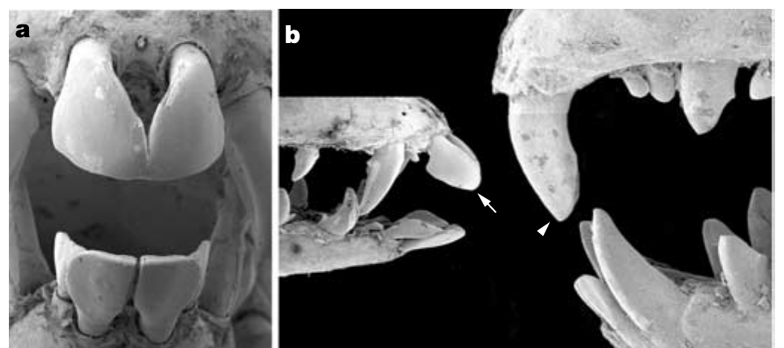
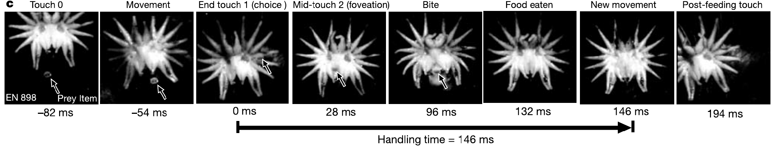
Specialized incisors complete close-range prey capture
After foveal inspection, the star-nosed mole captures small prey with its front teeth. Catania and Remple examined the dentition with scanning electron microscopy, which revealed how the teeth are built and arranged. The teeth are the last element in a capture sequence that begins with the star. Dental anatomy was therefore examined in the same study as the sensory surface.
The star-nosed mole's incisors are reduced and arranged in a tweezer-like configuration. High-speed sequences associate their use with the final movements of the star during capture of fragments as small as 0.8 mm across, and their proximity to the fovea minimizes the required approach. Because the teeth sit close to the star's sensing region, the grasp follows directly from inspection.
Anatomy and behavior support coordinated sensory and feeding specializations. Both features bring the sensing surface and the grasping teeth into one brief sequence, which suits small, quickly handled prey. The two specializations work as parts of one feeding system rather than as separate traits. Both appear in the same high-speed sequences, which ties sensing to grasping.
Catania & Remple (2005), Fig. 3(a–b). Specialized incisors compared with eastern mole teeth.
Catania & Remple (2005), Fig. 1(c). A second high-speed feeding sequence with original time labels.
Catania & Remple (2005)
09
Notes:
• After foveal inspection, the star-nosed mole captures small prey using its front teeth. Catania and Remple examined the dentition with scanning electron microscopy and compared it with eastern mole incisors. Incisors are the anterior teeth involved here in grasping, not sensory organs.
– The star detects and positions the target; the incisors grasp it. These are different mechanical functions even though they occur within a single brief feeding response.
• The star-nosed mole’s incisors are reduced and arranged in a tweezer-like configuration. High-speed sequences associate their use with the final movements of the star during capture of fragments as small as 0.8 mm across. Their proximity to the fovea minimizes the required approach.
• The anatomical comparison and behavior support coordinated sensory and feeding specializations. They do not measure tooth force or establish an evolutionary sequence through a tooth-removal experiment. Selection for rapid handling is the authors’ explanatory proposal, supported by performance and morphology rather than directly observed historical selection.
References:
Catania KC, Remple FE (2005). Asymptotic prey profitability drives star-nosed moles to the foraging speed limit. Nature 433(7025):519-522. https://doi.org/10.1038/nature03250
Figure: Catania & Remple (2005), Fig. 3(a–b). Specialized incisors compared with eastern mole teeth.
Figure source: https://doi.org/10.1038/nature03250
Figure: Catania & Remple (2005), Fig. 1(c). A second high-speed feeding sequence with original time labels.
Figure source: https://doi.org/10.1038/nature03250

Slide 12
Incisors and star perform different functions
Incisors are the anterior teeth involved in grasping, and they are not sensory organs. The star detects and positions the target, and the incisors grasp it. These are different mechanical functions, even though both occur within a single brief feeding response that begins with foveal inspection.
Eastern mole incisors served as the reference in the scanning electron microscopy analysis. Figure 3(a–b) of the study sets the reduced star-nosed mole teeth beside them, while Figure 1(c) adds a second high-speed feeding sequence with original time labels from the same study.
The authors propose that selection favored rapid handling. That proposal rests on performance and morphology, while the historical selection process was inferred rather than observed directly in these animals. The reduced incisors sit in a tweezer-like configuration next to the sensing rays.
Catania & Remple (2005), Fig. 3(a–b). Specialized incisors compared with eastern mole teeth.
Catania & Remple (2005), Fig. 1(c). A second high-speed feeding sequence with original time labels.
Catania & Remple (2005)
09a
Notes:
• Incisors and star perform different functions.
• Explanation 1.
– Incisors are the anterior teeth involved in grasping, and they are not sensory organs
– The star detects and positions the target, and the incisors grasp it. These are different mechanical functions, even though both occur within a single brief feeding response that begins with foveal inspection.
• Explanation 2.
– Eastern mole incisors served as the reference in the scanning electron microscopy analysis
– Figure 3(a–b) of the study sets the reduced star-nosed mole teeth beside them, while Figure 1(c) adds a second high-speed feeding sequence with original time labels from the same study.
• Explanation 3.
– The authors propose that selection favored rapid handling
– That proposal rests on performance and morphology, while the historical selection process was inferred rather than observed directly in these animals. The reduced incisors sit in a tweezer-like configuration next to the sensing rays.
• Source.
– The figure and the measurements come from Catania & Remple (2005).
– Each statement is tied to the recordings or observations of that study.
References:
Catania KC, Remple FE (2005). Asymptotic prey profitability drives star-nosed moles to the foraging speed limit. Nature 433(7025):519-522. https://doi.org/10.1038/nature03250

Slide 13
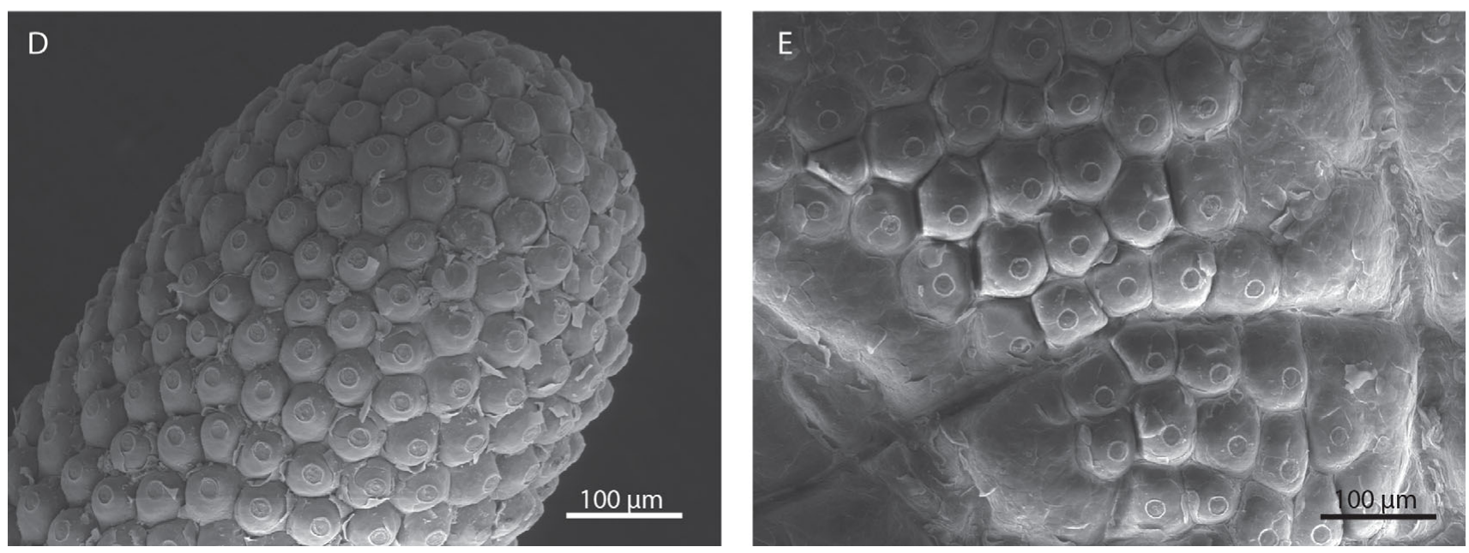
Eimer’s organs tile the contact surface
An Eimer's organ is a small epidermal sensory unit containing several types of nerve ending. The epidermis is the outer cellular layer of skin, and Sawyer and Catania used scanning electron microscopy to map these units across the flattened front surface of the star. The map covers the whole contact surface. The map is continuous across the front surface.
The star contains roughly 25,000 organs across its 22 rays. Surface images show separate domes packed into a repeated array, so receptor-unit position can be measured directly on the skin. The repeated array allows the investigators to measure spacing and density across each ray. Their repeated arrangement makes the star's surface a measurable sheet of sensory units.
Each dome has an external structure that can be identified without tracing its entire innervation, which is unusual among mammalian touch receptors. Counting organs therefore measures how the anatomical units are distributed across the star. The count describes the distribution of the sensory units, which is a different quantity from the number of nerve fibers.
Sawyer & Catania (2016), Fig. 1(D–E). Eimer’s organs on the ray surface and an individual organ.
Sawyer & Catania (2016), Fig. 1(A). The 22-ray tactile star.
Sawyer & Catania (2016); Catania & Kaas (1997)
10
Notes:
• An Eimer’s organ is a small epidermal sensory unit containing several types of nerve ending. The epidermis is the outer cellular layer of skin. Sawyer and Catania used scanning electron microscopy to map these units across the flattened front surface of the star.
– A sensory unit can contain multiple transducers with different response properties. Surface microscopy identifies unit boundaries but does not assign their functional receptive fields.
• The star contains roughly 25,000 organs across its 22 rays. Surface images reveal separate domes packed into a repeated array, making receptor-unit position measurable directly. Unlike many mammalian touch receptors, each unit has an external structure that can be identified without tracing its entire innervation.
• The visible dome is not equivalent to one neuron: several endings supply an organ, and individual fibers may branch. Counting organs measures the distribution of anatomical units, not independent neural channels. Tissue flattening and preparation must also be considered when comparing measurements with the living, moving star.
References:
Sawyer EK, Catania KC (2016). Somatosensory organ topography across the star of the star‐nosed mole (Condylura cristata). Journal of Comparative Neurology 524(5):917-929. https://doi.org/10.1002/cne.23943
Catania KC, Kaas JH (1997). Somatosensory fovea in the star-nosed mole: Behavioral use of the star in relation to innervation patterns and cortical representation. The Journal of Comparative Neurology 387(2):215-233. https://doi.org/10.1002/(sici)1096-9861(19971020)387:2<215::aid-cne4>3.0.co;2-3
Figure: Sawyer & Catania (2016), Fig. 1(D–E). Eimer’s organs on the ray surface and an individual organ.
Figure source: https://doi.org/10.1002/cne.23943
Figure: Sawyer & Catania (2016), Fig. 1(A). The 22-ray tactile star.
Figure source: https://doi.org/10.1002/cne.23943

Slide 14
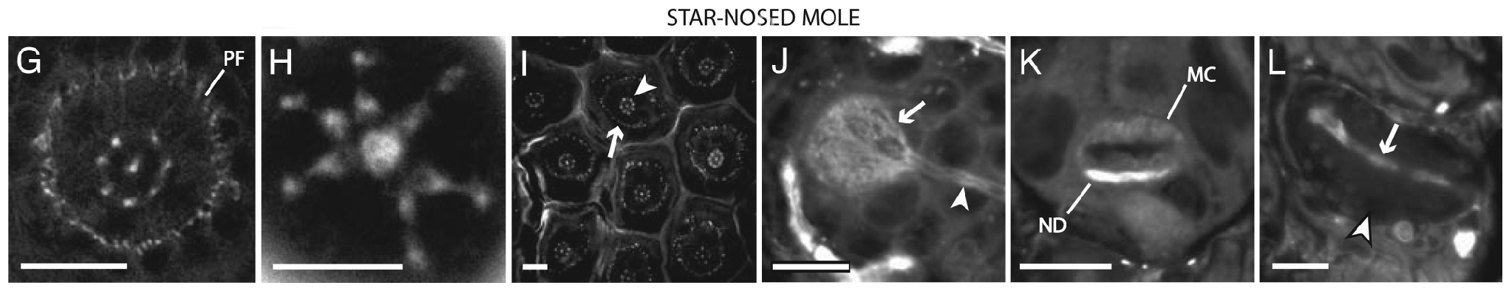
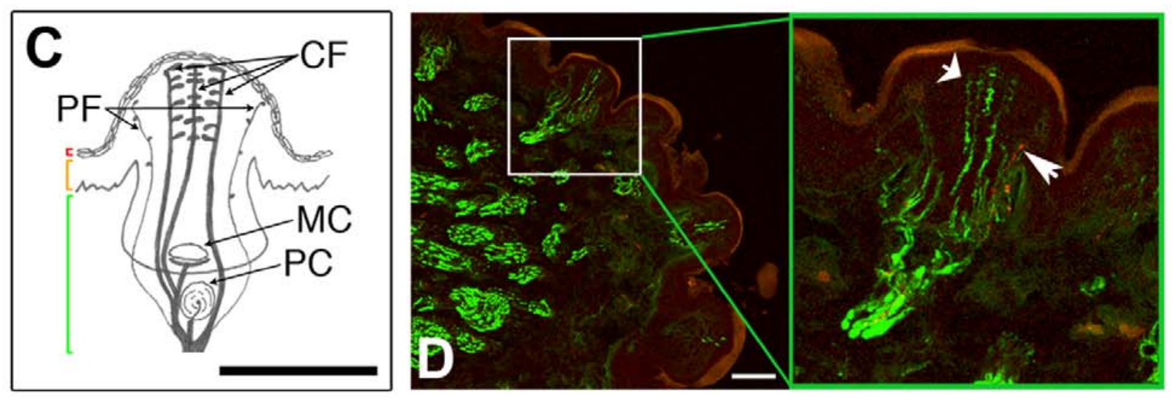
Central and peripheral endings occupy distinct rings
Marasco and colleagues used fluorescent dyes and confocal microscopy to examine star-nosed mole Eimer's organs. Confocal microscopy resolves selected optical depths, so the arrangement of nerve terminals can be compared across horizontal and vertical tissue sections. Viewing one organ from several planes shows how its endings are stacked and spaced. Each organ therefore shows its own spatial arrangement.
About 15 µm below an organ's apex, a central ending was surrounded by seven satellite fibers in the illustrated specimen. A second, outer ring contained smaller peripheral endings, and near the surface, terminal swellings of the satellite fibers approached the central terminal. The central ending and its ring therefore form a compact cluster inside each dome.
This organization provides several potential contact-sensitive elements within one dome. The ring pattern is anatomical evidence, so separate signals for direction or pain need physiological or molecular tests before they can be assigned. Each element is a candidate for a particular sensory role, and those roles are tested with other methods. The arrangement shows structure, not function.
Marasco et al. (2006), Fig. 3(G–L). Star-nosed mole sensory endings, Merkel complexes and corpuscle.
Gerhold et al. (2013), Fig. 1(C–D). Original organ anatomy and NF200/substance-P labeling.
Marasco et al. (2006); Gerhold et al. (2013)
11
Notes:
• Marasco and colleagues used fluorescent dyes and confocal microscopy to examine star-nosed mole Eimer’s organs. Confocal microscopy resolves selected optical depths, allowing the arrangement of nerve terminals to be compared in horizontal and vertical tissue sections rather than inferred from the surface alone.
– An apex is the top of a sensory dome. An optical section at a specified depth samples a different part of an ending from a section through its final superficial swelling.
• About 15 µm below an organ’s apex, a central ending was surrounded by seven satellite fibers in the illustrated specimen. A second, outer ring contained smaller peripheral endings. Near the surface, terminal swellings of the satellite fibers approached the central terminal.
• This organization provides several potential contact-sensitive elements within one dome. The ring arrangement is anatomical evidence; assigning separate signals for direction or pain requires physiological or molecular tests. A counted ring in one section does not establish an invariant number of endings in every organ.
References:
Marasco PD, Tsuruda PR, Bautista DM, Julius D, Catania KC (2006). Neuroanatomical evidence for segregation of nerve fibers conveying light touch and pain sensation in Eimer’s organ of the mole. Proceedings of the National Academy of Sciences 103(24):9339-9344. https://doi.org/10.1073/pnas.0603229103
Gerhold KA, Pellegrino M, Tsunozaki M, Morita T, Leitch DB, Tsuruda PR, Brem RB, Catania KC, Bautista DM (2013). The Star-Nosed Mole Reveals Clues to the Molecular Basis of Mammalian Touch. PLoS ONE 8(1):e55001. https://doi.org/10.1371/journal.pone.0055001
Figure: Marasco et al. (2006), Fig. 3(G–L). Star-nosed mole sensory endings, Merkel complexes and corpuscle.
Figure source: https://doi.org/10.1073/pnas.0603229103
Figure: Gerhold et al. (2013), Fig. 1(C–D). Original organ anatomy and NF200/substance-P labeling.
Figure source: https://doi.org/10.1371/journal.pone.0055001

Slide 15
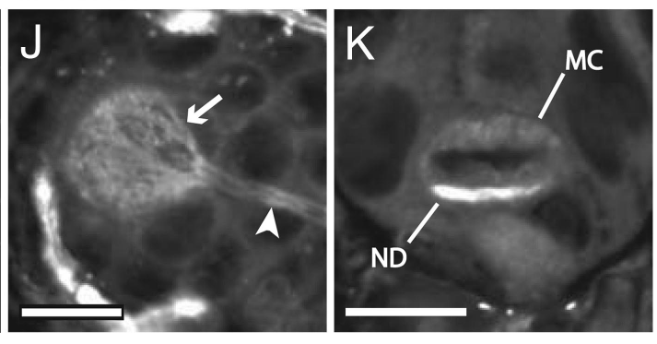
Merkel cells form complexes with sensory neurites
A Merkel cell–neurite complex couples a specialized epidermal cell to a sensory axon ending. Marasco and colleagues resolved these complexes near the base of star-nosed mole Eimer's organs using dye labeling, and the labeled neurite formed a disk against the Merkel cell. The complex is therefore a contact between a sensory process and a specialized skin cell.
Horizontal and vertical sections distinguished the neurite disk from the Merkel cell body. The original panels keep their 10-µm scale bars, which fix the size of each structure against a known length. Sectioning in two orientations is what made the disk visible as a separate part of the complex. These sections were paired with the dye labeling.
Its position and morphology support a receptor system for maintained contact. Morphology identifies structure rather than firing, so the complex's activity pattern is a question for recordings. The complex lies near the base of the organ, consistent with a receptor for maintained contact. Positions and shapes of the complex are reported in the same figures.
Marasco et al. (2006), Fig. 3(J–K). Merkel cell–neurite complexes in the star-nosed mole.
Gerhold et al. (2013), Fig. 1(C–D). Original organ anatomy and NF200/substance-P labeling.
Marasco et al. (2006); Gerhold et al. (2013); Marasco & Catania (2007)
12
Notes:
• A Merkel cell–neurite complex couples a specialized epidermal cell to a sensory axon ending. Marasco and colleagues resolved these complexes near the base of star-nosed mole Eimer’s organs using dye labeling. The labeled neurite formed a disk associated with the Merkel cell.
– A neurite is a neuronal process; the disk is the terminal part contacting the Merkel cell. Dye brightness should not be converted into a quantitative estimate of membrane current.
• Horizontal and vertical sections distinguished the neurite disk from the Merkel cell body. The neurite stained more strongly than the cell in the illustrated preparation, and the original panels retain 10-µm scale bars. The complex is separate from the superficial central and satellite endings.
• Its position and morphology support a receptor system for maintained contact, but morphology alone does not identify its firing pattern. The physiological study found Merkel-like slowly adapting responses; these were assigned by response characteristics rather than by tracing each recorded axon to a labeled complex.
References:
Marasco PD, Tsuruda PR, Bautista DM, Julius D, Catania KC (2006). Neuroanatomical evidence for segregation of nerve fibers conveying light touch and pain sensation in Eimer’s organ of the mole. Proceedings of the National Academy of Sciences 103(24):9339-9344. https://doi.org/10.1073/pnas.0603229103
Gerhold KA, Pellegrino M, Tsunozaki M, Morita T, Leitch DB, Tsuruda PR, Brem RB, Catania KC, Bautista DM (2013). The Star-Nosed Mole Reveals Clues to the Molecular Basis of Mammalian Touch. PLoS ONE 8(1):e55001. https://doi.org/10.1371/journal.pone.0055001
Marasco PD, Catania KC (2007). Response properties of primary afferents supplying Eimer's organ. Journal of Experimental Biology 210(5):765-780. https://doi.org/10.1242/jeb.02690
Figure: Marasco et al. (2006), Fig. 3(J–K). Merkel cell–neurite complexes in the star-nosed mole.
Figure source: https://doi.org/10.1073/pnas.0603229103
Figure: Gerhold et al. (2013), Fig. 1(C–D). Original organ anatomy and NF200/substance-P labeling.
Figure source: https://doi.org/10.1371/journal.pone.0055001

Slide 16
Dye staining is an anatomical observation
The neurite stained more strongly than the Merkel cell in the illustrated preparation. The complex sits separate from the superficial central and satellite endings of the same dome. A neurite is a neuronal process, and the disk is its terminal part that contacts the Merkel cell, which is a specialized epidermal cell.
Dye brightness in these preparations is treated as evidence of location. It is not converted into a quantitative estimate of membrane current, so the stain shows where a label sits in the tissue and says nothing about how strongly the cell is driven.
Marasco and Catania (2007) found Merkel-like slowly adapting responses in the same organ system. These responses were assigned to the complex by their response characteristics, and each recorded axon was not traced to a labeled complex in that study. The recordings were made in afferents of the trigeminal ganglion.
Marasco et al. (2006), Fig. 3(J–K). Merkel cell–neurite complexes in the star-nosed mole.
Gerhold et al. (2013), Fig. 1(C–D). Original organ anatomy and NF200/substance-P labeling.
Marasco et al. (2006); Marasco & Catania (2007)
12a
Notes:
• Dye staining is an anatomical observation.
• Explanation 1.
– The neurite stained more strongly than the Merkel cell in the illustrated preparation
– The complex sits separate from the superficial central and satellite endings of the same dome. A neurite is a neuronal process, and the disk is its terminal part that contacts the Merkel cell, which is a specialized epidermal cell.
• Explanation 2.
– Dye brightness in these preparations is treated as evidence of location
– It is not converted into a quantitative estimate of membrane current, so the stain shows where a label sits in the tissue and says nothing about how strongly the cell is driven.
• Explanation 3.
– Marasco and Catania (2007) found Merkel-like slowly adapting responses in the same organ system
– These responses were assigned to the complex by their response characteristics, and each recorded axon was not traced to a labeled complex in that study. The recordings were made in afferents of the trigeminal ganglion.
• Source.
– The figure and the measurements come from Marasco et al. (2006); Marasco & Catania (2007).
– Each statement is tied to the recordings or observations of that study.
References:
Marasco PD, Tsuruda PR, Bautista DM, Julius D, Catania KC (2006). Neuroanatomical evidence for segregation of nerve fibers conveying light touch and pain sensation in Eimer’s organ of the mole. Proceedings of the National Academy of Sciences 103(24):9339-9344. https://doi.org/10.1073/pnas.0603229103
Marasco PD, Catania KC (2007). Response properties of primary afferents supplying Eimer's organ. Journal of Experimental Biology 210(5):765-780. https://doi.org/10.1242/jeb.02690

Slide 17
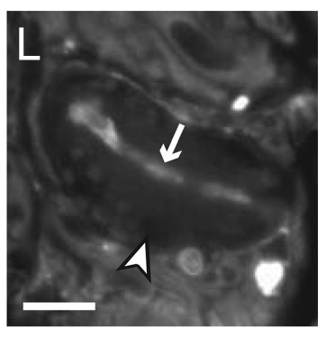
Lamellated corpuscles add a deep receptor component
A lamellated corpuscle contains a sensory ending surrounded by layered tissue. Marasco and colleagues localized this structure beneath the epidermis in Eimer's organs, where the terminal neurite ran through the capsule roughly parallel to the skin surface. The layered capsule wraps the terminal and sits deeper than the external ray. Its layers are visible under dye labeling.
The illustrated star-nosed mole organ contained one corpuscle, while coast mole organs commonly contained one or two. Dye labeled the sensory terminal while the surrounding capsule stayed relatively unlabeled, which places this receptor below the much larger external ray. The original 10-µm scale bar makes the depth of the structure clear. One corpuscle per organ was the illustrated case.
The arrangement is consistent with sensitivity to changing mechanical input. The skin unit integrates several receptor components, so a deep receptor component works alongside the more superficial endings of the same organ. Together these components give one organ several layers of mechanical sensing. These deeper components sit beneath the epidermis of each organ.
Marasco et al. (2006), Fig. 3(L). A lamellated corpuscle in the star-nosed mole.
Gerhold et al. (2013), Fig. 1(C–D). Original organ anatomy and NF200/substance-P labeling.
Marasco et al. (2006); Gerhold et al. (2013); Marasco & Catania (2007)
13
Notes:
• A lamellated corpuscle contains a sensory ending surrounded by layered tissue. Marasco and colleagues localized this structure beneath the epidermis in Eimer’s organs. The terminal neurite ran through the capsule and lay approximately parallel to the skin surface.
– The capsule and axon ending are different structures. A fluorescent terminal inside an unlabeled capsule supports anatomical localization without establishing how the capsule mechanically filters a stimulus.
• The illustrated star-nosed mole organ contained one corpuscle, whereas coast mole organs commonly contained one or two. Dye labeled the sensory terminal while the surrounding capsule remained relatively unlabeled. The original 10-µm scale bar places this receptor below the much larger external ray.
• The arrangement is consistent with sensitivity to changing mechanical input. Pacinian-like rapidly adapting responses were independently recorded from mole nasal afferents, but anatomical resemblance does not prove that every such response originated in this particular terminal. The skin unit integrates several receptor components.
References:
Marasco PD, Tsuruda PR, Bautista DM, Julius D, Catania KC (2006). Neuroanatomical evidence for segregation of nerve fibers conveying light touch and pain sensation in Eimer’s organ of the mole. Proceedings of the National Academy of Sciences 103(24):9339-9344. https://doi.org/10.1073/pnas.0603229103
Gerhold KA, Pellegrino M, Tsunozaki M, Morita T, Leitch DB, Tsuruda PR, Brem RB, Catania KC, Bautista DM (2013). The Star-Nosed Mole Reveals Clues to the Molecular Basis of Mammalian Touch. PLoS ONE 8(1):e55001. https://doi.org/10.1371/journal.pone.0055001
Marasco PD, Catania KC (2007). Response properties of primary afferents supplying Eimer's organ. Journal of Experimental Biology 210(5):765-780. https://doi.org/10.1242/jeb.02690
Figure: Marasco et al. (2006), Fig. 3(L). A lamellated corpuscle in the star-nosed mole.
Figure source: https://doi.org/10.1073/pnas.0603229103
Figure: Gerhold et al. (2013), Fig. 1(C–D). Original organ anatomy and NF200/substance-P labeling.
Figure source: https://doi.org/10.1371/journal.pone.0055001

Slide 18
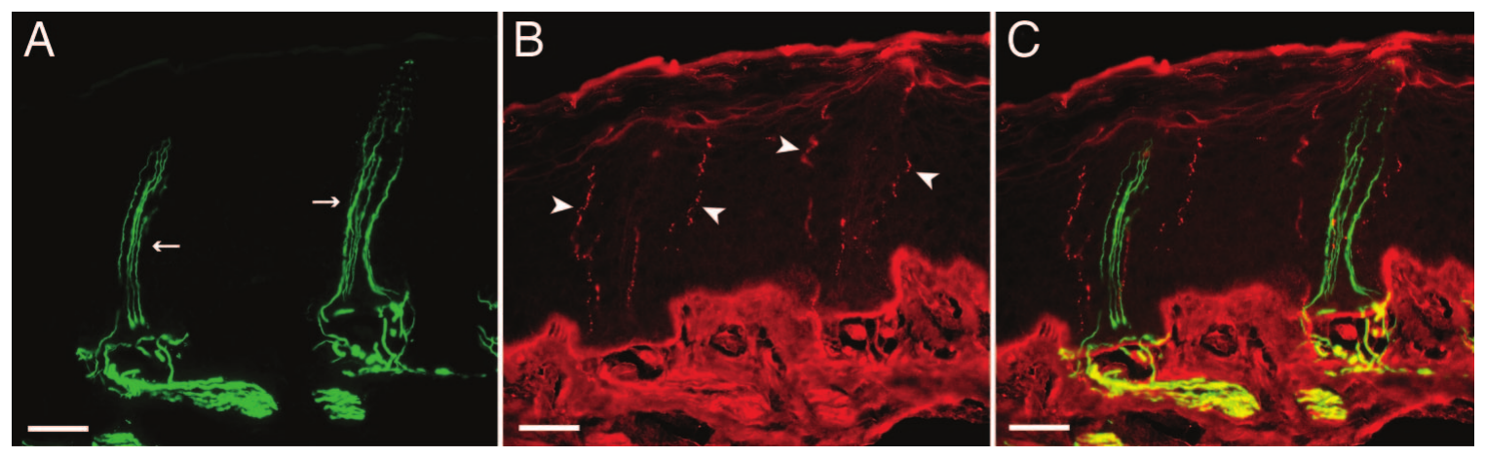
Molecular markers separate touch-associated endings
NF200 is a neurofilament marker associated with many large, myelinated sensory fibers. Substance P is a neuropeptide associated with a subset of pain-signaling neurons, and Marasco and colleagues double-labeled coast mole Eimer's organs to compare these populations within one structure. Two markers in one organ make it possible to see which endings carry each label.
Central and satellite endings labeled for NF200, whereas the outer peripheral ring labeled for substance P. Gerhold and colleagues later found strong NF200 staining and sparse peripheral substance-P staining in star-nosed mole organs, so terminal position and marker identity both help define the endings. The two studies agree on the outer ring.
These markers support light-touch and nociceptive specialization, and a nociceptor detects potentially damaging stimulation. Marker identity and anatomical position suggest function, while a definitive functional assignment needs recording or selective intervention in the labeled fibers. Labeling therefore narrows the list of candidate functions for each ending. The two patterns point to different candidate functions.
Marasco et al. (2006), Fig. 5(A–C). NF200 and substance-P labeling in the coast mole.
Gerhold et al. (2013), Fig. 1(C–D). Original organ anatomy and NF200/substance-P labeling.
Marasco et al. (2006); Gerhold et al. (2013)
14
Notes:
• NF200 is a neurofilament marker associated with many large, myelinated sensory fibers. Substance P is a neuropeptide associated with a subset of pain-signaling neurons. Marasco and colleagues double-labeled coast mole Eimer’s organs to compare these populations within the same structure.
– The coast-mole micrographs provide the clearest double-label comparison; the accompanying star-nosed mole panel supplies species-specific anatomy. Published fluorescence colors are preserved, including the original overlapping labels.
• Central and satellite endings labeled for NF200, whereas the outer peripheral ring labeled for substance P. Gerhold and colleagues subsequently found strong NF200 staining and sparse peripheral substance-P staining in star-nosed mole organs. The two studies distinguish terminal position from a single undifferentiated ring.
• These markers support light-touch and nociceptive specialization, but do not directly measure transmitter release or behavioral pain. A nociceptor detects potentially damaging stimulation. Marker identity and anatomical position suggest function; a definitive functional assignment requires recording or selective intervention in the labeled fibers.
References:
Marasco PD, Tsuruda PR, Bautista DM, Julius D, Catania KC (2006). Neuroanatomical evidence for segregation of nerve fibers conveying light touch and pain sensation in Eimer’s organ of the mole. Proceedings of the National Academy of Sciences 103(24):9339-9344. https://doi.org/10.1073/pnas.0603229103
Gerhold KA, Pellegrino M, Tsunozaki M, Morita T, Leitch DB, Tsuruda PR, Brem RB, Catania KC, Bautista DM (2013). The Star-Nosed Mole Reveals Clues to the Molecular Basis of Mammalian Touch. PLoS ONE 8(1):e55001. https://doi.org/10.1371/journal.pone.0055001
Figure: Marasco et al. (2006), Fig. 5(A–C). NF200 and substance-P labeling in the coast mole.
Figure source: https://doi.org/10.1073/pnas.0603229103
Figure: Gerhold et al. (2013), Fig. 1(C–D). Original organ anatomy and NF200/substance-P labeling.
Figure source: https://doi.org/10.1371/journal.pone.0055001

Slide 19
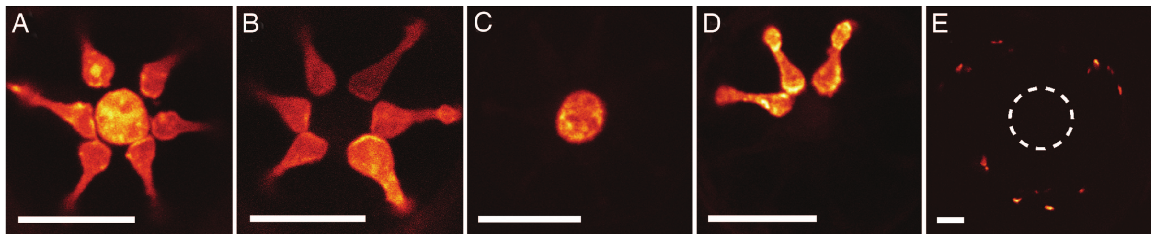
Dye fills reveal branching within the organ
Marasco and colleagues applied DiI, a lipophilic dye that spreads within cell membranes, to trace free nerve endings in star-nosed mole Eimer's organs. Tracing shows whether nearby terminal profiles belong to separate fibers or share one underlying neuronal process. Dye placed on one fiber follows that fiber's membrane through the organ. Organs were traced individually.
The central and satellite terminals could label together within a single organ, and adjacent organs sometimes contained labeled central and satellite profiles. Across optical sections, the dye revealed branches and terminal swellings that would otherwise look like isolated points. Several profiles that look separate in one section can turn out to be parts of one fiber.
These observations support branching of afferents across the organ's specialized endings. One fiber can therefore supply several terminal profiles within an organ, which changes how each terminal should be counted. Counting terminals alone would overstate the number of independent fibers. Counting these profiles requires knowing which fiber each belongs to. Dye tracing supplies that information.
Marasco et al. (2006), Fig. 6(A–E). DiI fills of central and satellite endings in star-nosed mole organs.
Marasco et al. (2006)
15
Notes:
• Marasco and colleagues applied DiI, a lipophilic dye that spreads within cell membranes, to trace free nerve endings in star-nosed mole Eimer’s organs. Tracing tests whether nearby terminal profiles belong to separate fibers or share an underlying neuronal process.
– A branch can distribute one axon’s peripheral territory without adding another ganglion cell. Organ counts, terminal counts and sensory-neuron counts therefore measure different levels of the system.
• The central and satellite terminals could label together within a single organ. Adjacent organs sometimes also contained labeled central and satellite profiles. Across optical sections, the dye revealed branches and terminal swellings that would otherwise resemble separate isolated points.
• These observations support branching of afferents across the organ’s specialized endings. Dye spread depends on exposure and membrane continuity, so an unlabeled profile does not prove lack of innervation. Tracing also identifies anatomy rather than mechanical threshold, electrical coupling or a synaptic connection between terminal profiles.
References:
Marasco PD, Tsuruda PR, Bautista DM, Julius D, Catania KC (2006). Neuroanatomical evidence for segregation of nerve fibers conveying light touch and pain sensation in Eimer’s organ of the mole. Proceedings of the National Academy of Sciences 103(24):9339-9344. https://doi.org/10.1073/pnas.0603229103
Figure: Marasco et al. (2006), Fig. 6(A–E). DiI fills of central and satellite endings in star-nosed mole organs.
Figure source: https://doi.org/10.1073/pnas.0603229103

Slide 20
Dye fills trace branches of one axon
A branch can distribute one axon's peripheral territory without adding another ganglion cell. Organ counts, terminal counts and sensory-neuron counts measure different levels of the system. Figure 6(A–E) of the study shows DiI fills of central and satellite endings in star-nosed mole organs.
Dye spread depends on exposure time and membrane continuity. An unlabeled profile leaves open whether innervation is absent, because labeling depends on those two factors, while a labeled profile is evidence of continuity between profiles in the tissue. Dye was applied to free nerve endings in the star-nosed mole's Eimer's organs.
Tracing identifies anatomy rather than mechanical threshold, electrical coupling or a synaptic connection between terminal profiles. Across the optical sections, the fills resolved each terminal profile's position within the organ's tissue, which is the level the DiI results describe.
Marasco et al. (2006), Fig. 6(A–E). DiI fills of central and satellite endings in star-nosed mole organs.
Marasco et al. (2006)
15a
Notes:
• Dye fills trace branches of one axon.
• Explanation 1.
– A branch can distribute one axon's peripheral territory without adding another ganglion cell
– Organ counts, terminal counts and sensory-neuron counts measure different levels of the system. Figure 6(A–E) of the study shows DiI fills of central and satellite endings in star-nosed mole organs.
• Explanation 2.
– Dye spread depends on exposure time and membrane continuity
– An unlabeled profile leaves open whether innervation is absent, because labeling depends on those two factors, while a labeled profile is evidence of continuity between profiles in the tissue. Dye was applied to free nerve endings in the star-nosed mole's Eimer's organs.
• Explanation 3.
– Tracing identifies anatomy rather than mechanical threshold, electrical coupling or a synaptic connection between terminal profiles
– Across the optical sections, the fills resolved each terminal profile's position within the organ's tissue, which is the level the DiI results describe.
• Source.
– The figure and the measurements come from Marasco et al. (2006).
– Each statement is tied to the recordings or observations of that study.
References:
Marasco PD, Tsuruda PR, Bautista DM, Julius D, Catania KC (2006). Neuroanatomical evidence for segregation of nerve fibers conveying light touch and pain sensation in Eimer’s organ of the mole. Proceedings of the National Academy of Sciences 103(24):9339-9344. https://doi.org/10.1073/pnas.0603229103

Slide 21
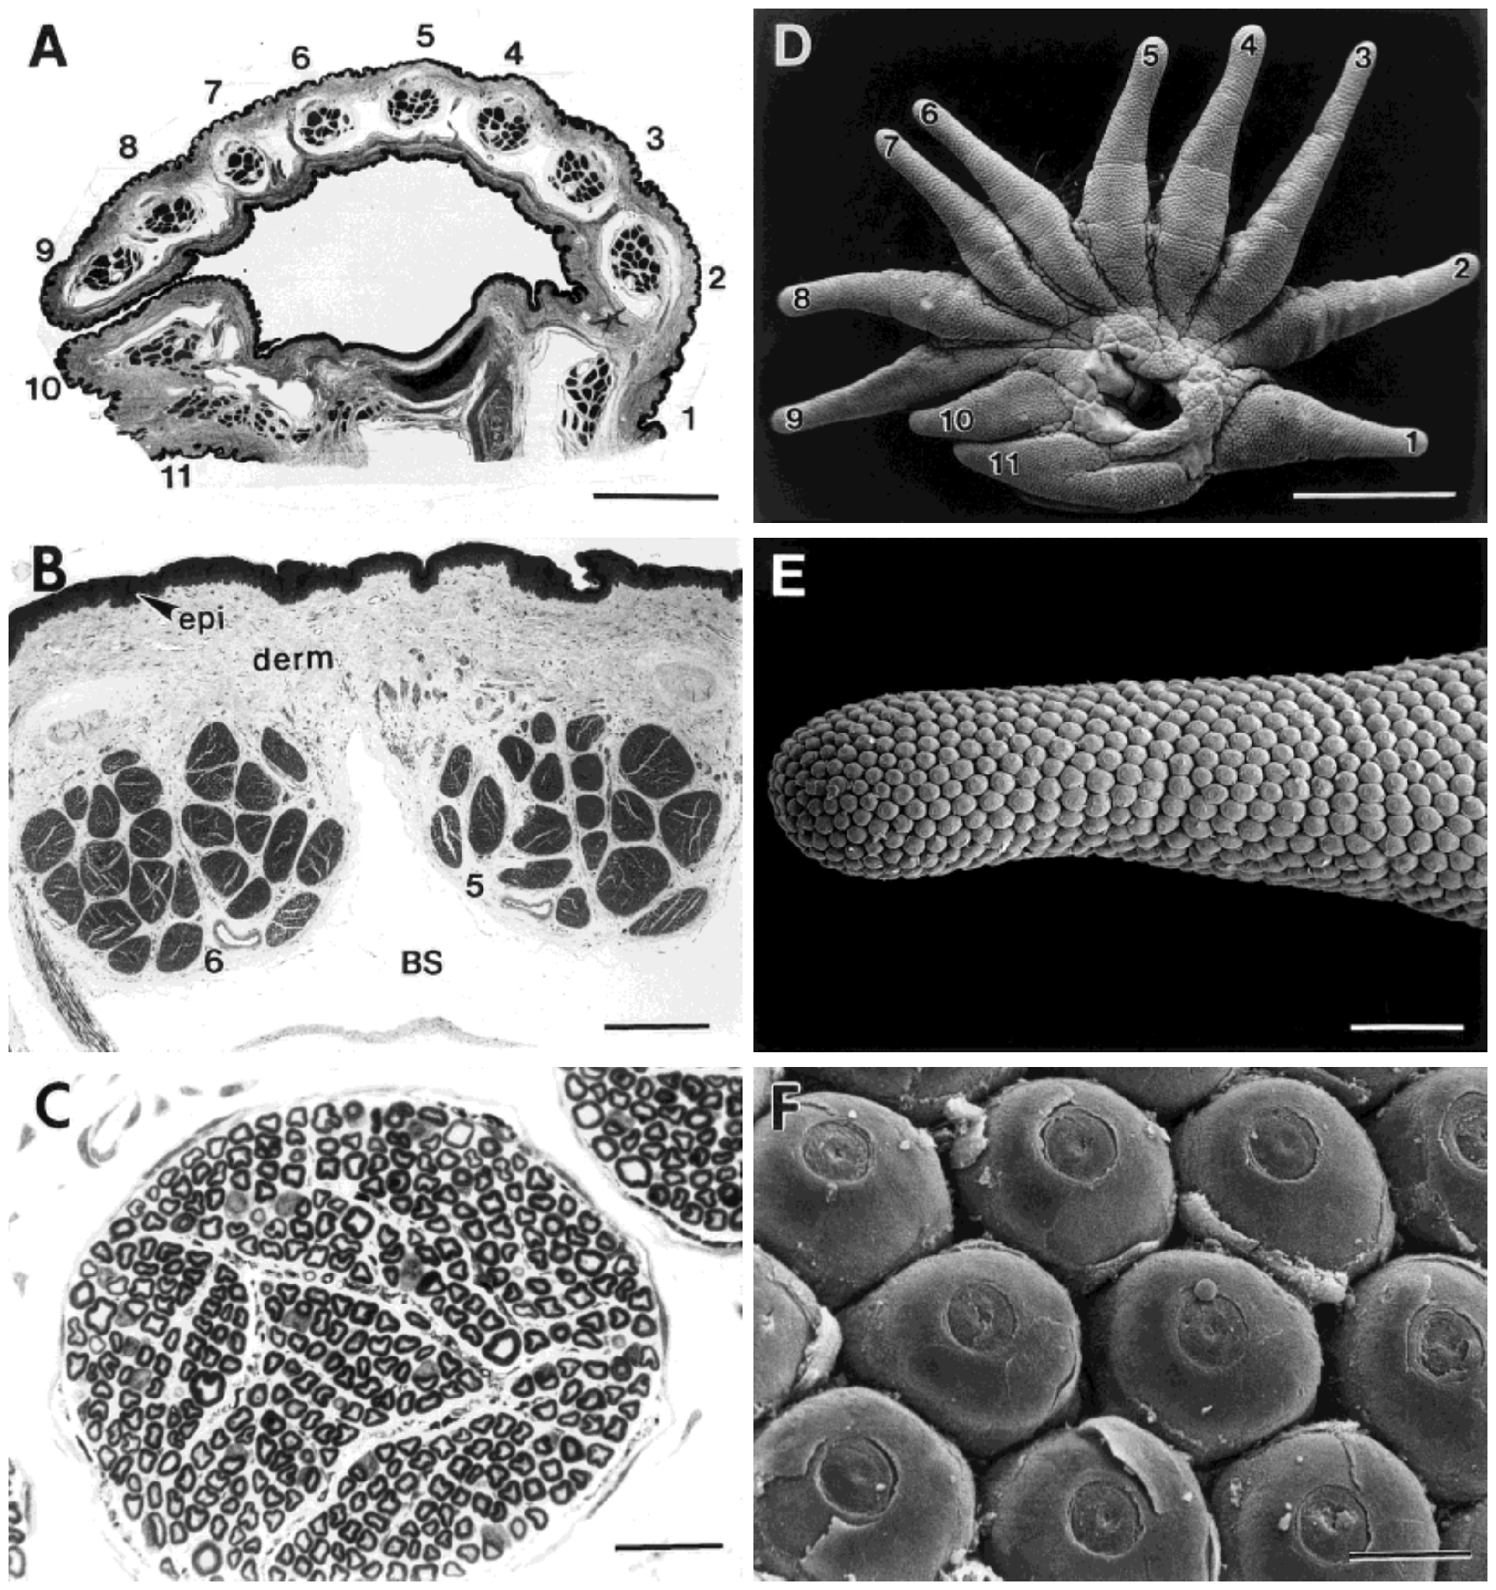
Separate nerve branches supply individual rays
Catania and Kaas sectioned the base of the star and examined its myelinated nerves. Myelin is the insulating sheath around many axons, and a primary afferent is a sensory neuron carrying peripheral information toward the central nervous system. The sections reveal the nerve bundles that run to the rays. Thin sections make each bundle visible.
One branch supplied each of the 11 rays on a side. Thin sections exposed separate nerve bundles and individual myelinated fibers, so counts could be related to the corresponding ray's sensory organs and cortical stripe. Each ray therefore has an identifiable nerve supply that can be followed from the star to the cortex.
This arrangement offers a tractable way to measure afferent allocation, and myelinated-fiber counts can be paired with organ counts. Counting fibers and counting organs are complementary measurements, each adding a different view of sensory resolution. Pairing the two counts gives a more complete picture of each ray's investment. Each count is therefore a measure of afferent allocation for its ray.
Catania & Kaas (1997), Fig. 6(A–F). Ray nerve bundles, myelinated fibers and receptor-bearing surface.
Gerhold et al. (2013), Fig. 1(C–D). Original organ anatomy and NF200/substance-P labeling.
Catania & Kaas (1997); Gerhold et al. (2013)
16
Notes:
• Catania and Kaas sectioned the base of the star and examined its myelinated nerves. Myelin is the insulating sheath around many axons. A primary afferent is a sensory neuron carrying peripheral information toward the central nervous system.
– A nerve branch is a bundle containing many axons. The investigators counted profiles within those bundles; the bundle itself is not one functional sensory channel.
• One branch supplied each of the 11 rays on a side. Thin sections exposed separate nerve bundles and individual myelinated fibers, allowing counts to be related to the corresponding ray’s sensory organs and cortical stripe. This preserves the anatomical identity of peripheral inputs during comparison.
• The branch arrangement provides a tractable way to measure afferent allocation, but myelinated-fiber counts omit unmyelinated fibers. They also do not specify the number of receptor endings supplied by each axon. Counting fibers and counting organs are complementary measurements, rather than interchangeable estimates of sensory resolution.
References:
Catania KC, Kaas JH (1997). Somatosensory fovea in the star-nosed mole: Behavioral use of the star in relation to innervation patterns and cortical representation. The Journal of Comparative Neurology 387(2):215-233. https://doi.org/10.1002/(sici)1096-9861(19971020)387:2<215::aid-cne4>3.0.co;2-3
Gerhold KA, Pellegrino M, Tsunozaki M, Morita T, Leitch DB, Tsuruda PR, Brem RB, Catania KC, Bautista DM (2013). The Star-Nosed Mole Reveals Clues to the Molecular Basis of Mammalian Touch. PLoS ONE 8(1):e55001. https://doi.org/10.1371/journal.pone.0055001
Figure: Catania & Kaas (1997), Fig. 6(A–F). Ray nerve bundles, myelinated fibers and receptor-bearing surface.
Figure source: https://doi.org/10.1002/(sici)1096-9861(19971020)387:2<215::aid-cne4>3.0.co;2-3
Figure: Gerhold et al. (2013), Fig. 1(C–D). Original organ anatomy and NF200/substance-P labeling.
Figure source: https://doi.org/10.1371/journal.pone.0055001

Slide 22
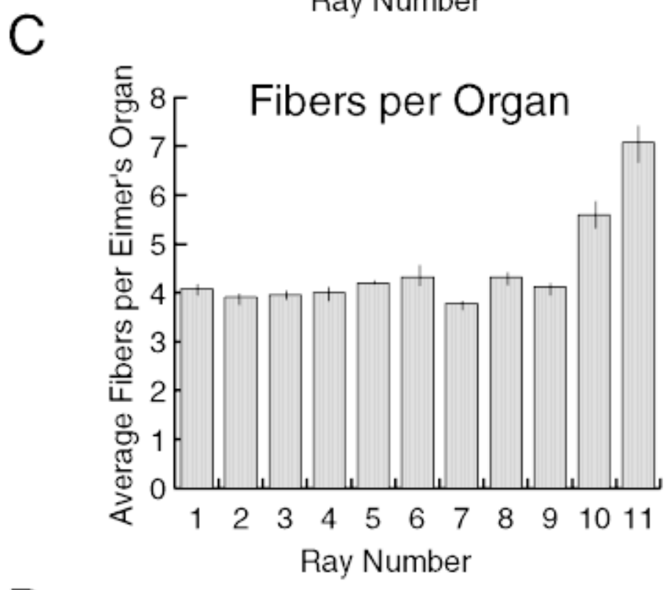
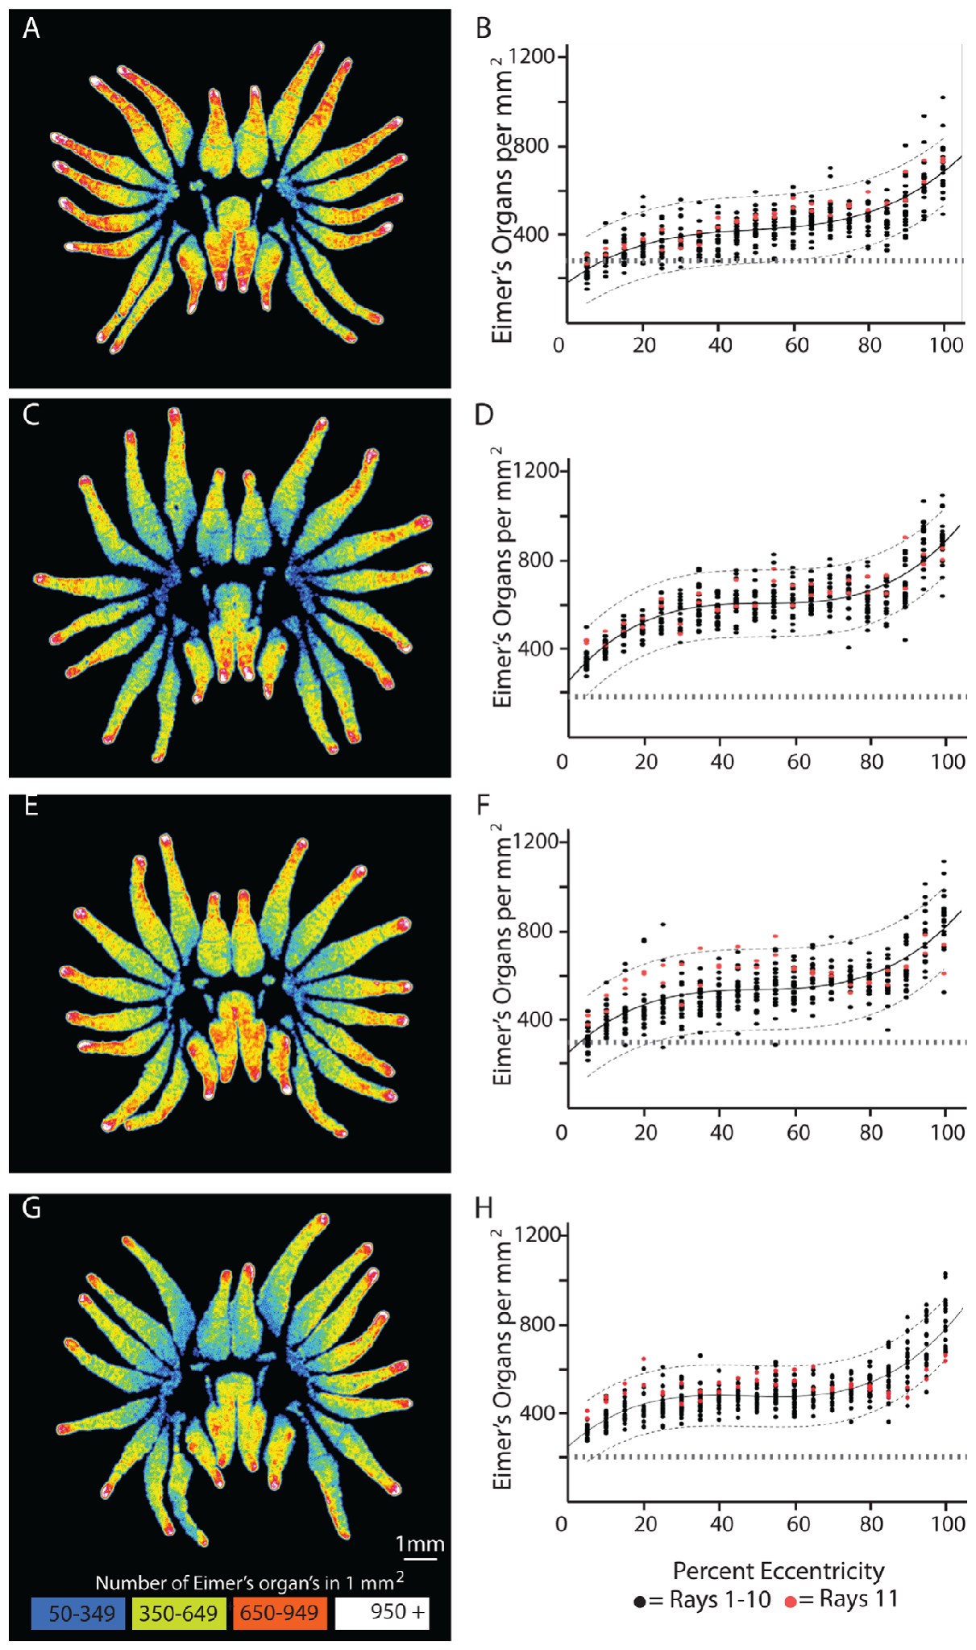
Ray 11 has more afferents per sensory organ
Catania and Kaas combined Eimer's-organ counts with myelinated-fiber counts for each ray. Innervation density per organ describes the number of counted afferents relative to the number of anatomical sensory units. This measure is a ratio, so it can differ between rays even when their organ counts are similar. The measure is expressed per organ.
The small eleventh ray contained relatively few organs but the highest number of afferents per organ. Organ surface density showed no equivalent peak at ray 11, so foveal specialization includes differences beneath the sensory surface that dome counts alone miss. The fovea is distinguished by how many fibers serve each organ, rather than by how many organs it has.
This association supports richer neural sampling of the foveal organs. Branching, response properties and central allocation all shape how the same anatomical surface gets represented in the brain. Each of these steps adds another layer between the skin and the cortical map. Dome counts and fiber counts therefore answer different questions. Both counts are needed.
Catania & Kaas (1997), Fig. 7(C). Myelinated fibers per Eimer’s organ across rays.
Sawyer & Catania (2016), Fig. 3(A–H). Original organ-density maps and longitudinal density profiles.
Catania & Kaas (1997); Sawyer & Catania (2016)
17
Notes:
• Catania and Kaas combined Eimer’s-organ counts with myelinated-fiber counts for each ray. Innervation density per organ describes the number of counted afferents relative to the number of anatomical sensory units, rather than the number of domes per square millimeter.
– An organ can have typical spacing while receiving unusually many sensory fibers. This distinguishes peripheral neural investment from a claim that the fovea simply contains the greatest number of visible domes.
• The small eleventh ray contained relatively few organs but the highest number of afferents per organ. Organ surface density did not display an equivalent special peak at ray 11. Foveal specialization therefore includes differences beneath the sensory surface that dome counts alone miss.
• This association supports richer neural sampling of the foveal organs. It does not establish one independent signal for every counted fiber or prove that innervation alone determines behavioral acuity. Branching, response properties and central allocation all affect how the same anatomical surface can be represented.
References:
Catania KC, Kaas JH (1997). Somatosensory fovea in the star-nosed mole: Behavioral use of the star in relation to innervation patterns and cortical representation. The Journal of Comparative Neurology 387(2):215-233. https://doi.org/10.1002/(sici)1096-9861(19971020)387:2<215::aid-cne4>3.0.co;2-3
Sawyer EK, Catania KC (2016). Somatosensory organ topography across the star of the star‐nosed mole (Condylura cristata). Journal of Comparative Neurology 524(5):917-929. https://doi.org/10.1002/cne.23943
Figure: Catania & Kaas (1997), Fig. 7(C). Myelinated fibers per Eimer’s organ across rays.
Figure source: https://doi.org/10.1002/(sici)1096-9861(19971020)387:2<215::aid-cne4>3.0.co;2-3
Figure: Sawyer & Catania (2016), Fig. 3(A–H). Original organ-density maps and longitudinal density profiles.
Figure source: https://doi.org/10.1002/cne.23943

Slide 23
Receptor density rises toward the ray tips
Sawyer and Catania measured Eimer's-organ positions on flattened stars using scanning electron microscopy. Eccentricity here means normalized distance along a ray from its base toward its tip. The normalized scale places every ray on the same base-to-tip axis, so positions can be compared between rays. Each recorded position is therefore a point on the surface, not a depth.
Mean density increased from about 228 organs/mm² near the star center to 391 at ray bases, 516 in middle regions and 718 near the tips. Density rose near the base, plateaued through much of the ray, and then increased again in its distal portion. The pattern is a stepwise climb from center to tip rather than a single smooth slope.
The gradient suggests that contact location changes the density of sampled units even within one ray. Tip regions therefore carry more sensory units per millimeter than the base does. Units packed more tightly at the tip give the star a finer sampling grid where prey is most often touched. Distal sampling is finer than basal sampling.
Sawyer & Catania (2016), Fig. 3(A–H). Original organ-density maps and longitudinal density profiles.
Sawyer & Catania (2016)
18
Notes:
• Sawyer and Catania measured Eimer’s-organ positions on flattened stars using scanning electron microscopy. Eccentricity here means normalized distance along a ray from its base toward its tip. Comparing this coordinate across rays separates longitudinal position from ray identity.
– The heat maps retain the authors’ original scale and colors. Their color represents measured organ density, not cortical magnification or the sensitivity of an individual axon.
• Mean density increased from about 228 organs/mm² near the star center to 391 at ray bases, 516 in middle regions and 718 near the tips. Density rose near the base, plateaued through much of the ray, then increased again in its distal portion.
• The gradient suggests that contact location changes the density of sampled units even within one ray. It does not directly measure a matching gradient in discrimination thresholds. Flattened-surface measurements and original fitted curves describe anatomy; they are not recordings of receptor activity during active searching.
References:
Sawyer EK, Catania KC (2016). Somatosensory organ topography across the star of the star‐nosed mole (Condylura cristata). Journal of Comparative Neurology 524(5):917-929. https://doi.org/10.1002/cne.23943
Figure: Sawyer & Catania (2016), Fig. 3(A–H). Original organ-density maps and longitudinal density profiles.
Figure source: https://doi.org/10.1002/cne.23943

Slide 24
Map colors encode measured organ density
The heat maps keep the authors' original scale and colors. Their color codes measured organ density, which differs from cortical magnification and from the sensitivity of an individual axon. Organ positions were measured on flattened stars by scanning electron microscopy, and density was computed from those positions.
The published curves are fitted to measured organ positions on flattened stars. The original fitted curves describe anatomy, and they summarize how organ density rises from the star's center outward to the ray tips, passing through the ray bases and middle regions.
The flattened-surface measurements are not recordings of receptor activity during active searching. The density pattern describes where sensory units sit on the surface, and it says nothing about how often each unit fires during a search. Normalized eccentricity places positions from all rays onto one shared axis from base to tip.
Sawyer & Catania (2016), Fig. 3(A–H). Original organ-density maps and longitudinal density profiles.
Sawyer & Catania (2016)
18a
Notes:
• Map colors encode measured organ density.
• Explanation 1.
– The heat maps keep the authors' original scale and colors
– Their color codes measured organ density, which differs from cortical magnification and from the sensitivity of an individual axon. Organ positions were measured on flattened stars by scanning electron microscopy, and density was computed from those positions.
• Explanation 2.
– The published curves are fitted to measured organ positions on flattened stars
– The original fitted curves describe anatomy, and they summarize how organ density rises from the star's center outward to the ray tips, passing through the ray bases and middle regions.
• Explanation 3.
– The flattened-surface measurements are not recordings of receptor activity during active searching
– The density pattern describes where sensory units sit on the surface, and it says nothing about how often each unit fires during a search. Normalized eccentricity places positions from all rays onto one shared axis from base to tip.
• Source.
– The figure and the measurements come from Sawyer & Catania (2016).
– Each statement is tied to the recordings or observations of that study.
References:
Sawyer EK, Catania KC (2016). Somatosensory organ topography across the star of the star‐nosed mole (Condylura cristata). Journal of Comparative Neurology 524(5):917-929. https://doi.org/10.1002/cne.23943

Slide 25
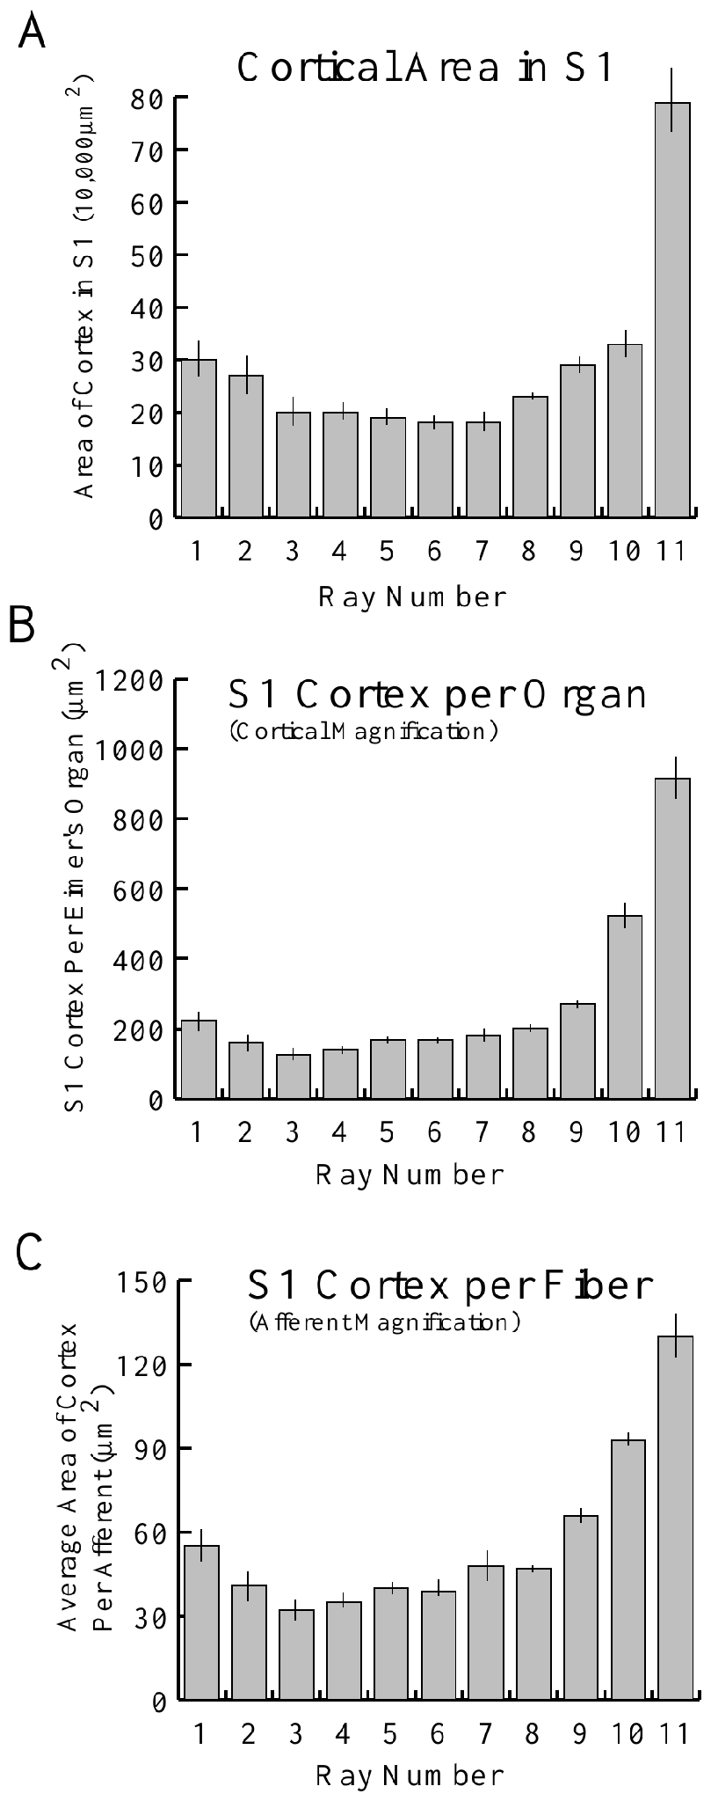
The fovea lacks an exceptional dome-density peak
Sawyer and Catania compared receptor density across numbered rays while accounting for position along each ray. Distal regions are more densely packed than basal regions, so an entire foveal ray must be compared at matching positions. This control makes the ray-by-ray measure fair. Matching positions remove the effect of position along the ray.
Ray 11 had no higher overall Eimer's-organ density than the other rays. Nevertheless, Catania and Kaas found much greater cortical area per organ for ray 11, so the tactile fovea differs from an explanation based solely on extra receptor units per surface area. The fovea is therefore explained by what each unit feeds rather than by how many units there are.
The findings establish a mismatch between dome density and central allocation. Central magnification is one measured contributor to foveal acuity, alongside specialized ending types and afferent investment per organ. Each of these contributors adds a different layer to the explanation. Each one can be measured on its own. These factors are separate in the analysis.
Sawyer & Catania (2016), Fig. 3(A–H). Original organ-density maps and longitudinal density profiles.
Catania & Kaas (1997), Fig. 12(A–C). Cortical area and its normalization by organs and afferents.
Sawyer & Catania (2016); Catania & Kaas (1997)
19
Notes:
• Sawyer and Catania compared receptor density across numbered rays while accounting for position along each ray. The distinction matters because distal regions are more densely packed than basal regions. Comparing an entire foveal ray with another ray’s tip would mix two effects.
– The same anatomical density can support different neural representations. More cortical tissue assigned to an organ is not the same variable as more organs assigned to a millimeter of skin.
• Ray 11 did not possess higher overall Eimer’s-organ density than the other rays. Nevertheless, Catania and Kaas found much greater cortical area per organ for ray 11. The tactile fovea therefore differs from an explanation based solely on extra receptor units per surface area.
• The findings establish a mismatch between dome density and central allocation. They do not rule out specialized ending types, greater afferent investment per organ or mechanical differences in foveal skin. Central magnification is one measured contributor, rather than a complete explanation of every aspect of foveal acuity.
References:
Sawyer EK, Catania KC (2016). Somatosensory organ topography across the star of the star‐nosed mole (Condylura cristata). Journal of Comparative Neurology 524(5):917-929. https://doi.org/10.1002/cne.23943
Catania KC, Kaas JH (1997). Somatosensory fovea in the star-nosed mole: Behavioral use of the star in relation to innervation patterns and cortical representation. The Journal of Comparative Neurology 387(2):215-233. https://doi.org/10.1002/(sici)1096-9861(19971020)387:2<215::aid-cne4>3.0.co;2-3
Figure: Sawyer & Catania (2016), Fig. 3(A–H). Original organ-density maps and longitudinal density profiles.
Figure source: https://doi.org/10.1002/cne.23943
Figure: Catania & Kaas (1997), Fig. 12(A–C). Cortical area and its normalization by organs and afferents.
Figure source: https://doi.org/10.1002/(sici)1096-9861(19971020)387:2<215::aid-cne4>3.0.co;2-3

Slide 26
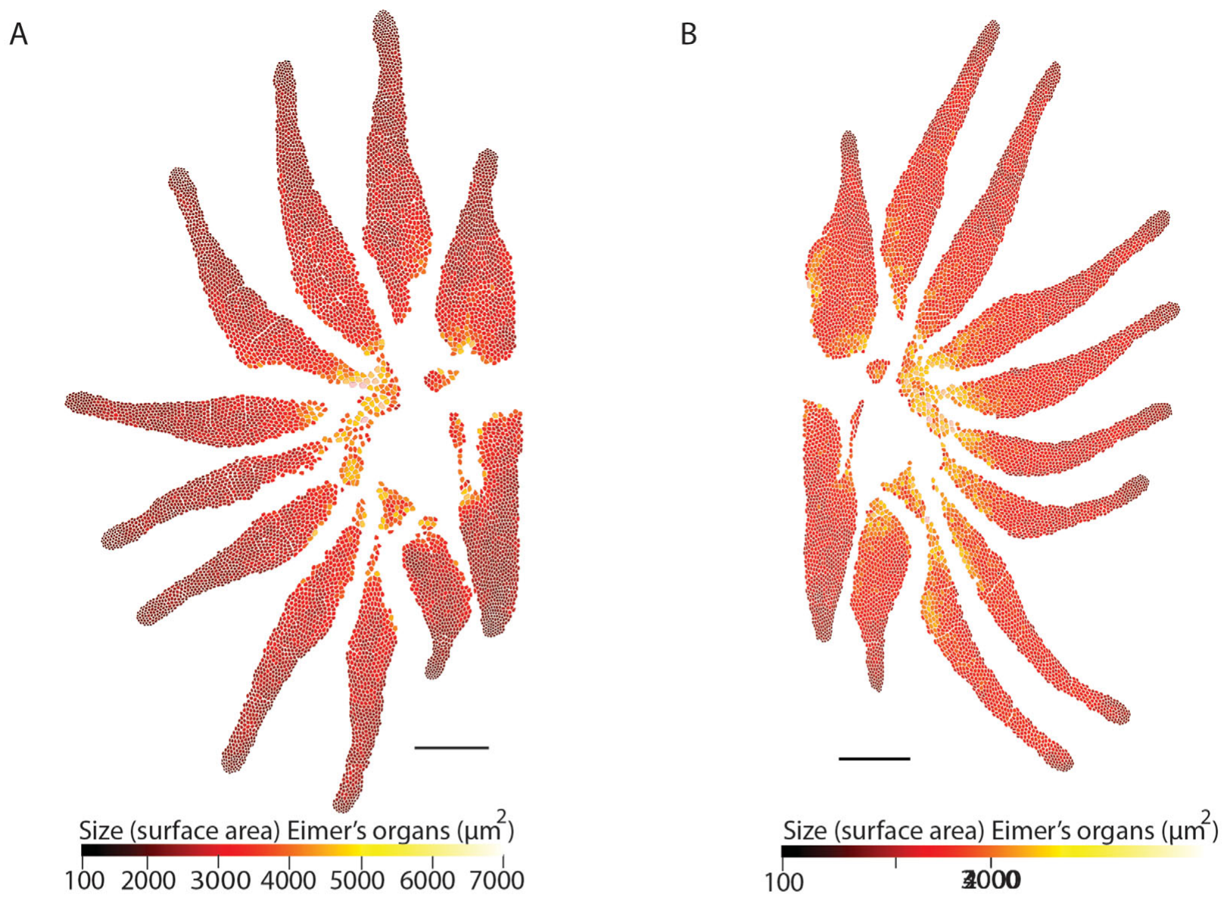
Individual organ size varies across the star
Sawyer and Catania traced the frontal surface area of individual Eimer's organs in scanning electron micrographs. Surface area here describes a dome's visible footprint, which is a property of the skin surface rather than of a neuron's receptive field. The measurement captures how much skin each dome covers. Its value is an area, not a count.
Large organs were generally more common near the star's center, whereas smaller organs occurred toward densely packed distal regions. In the examined stars, the largest organs had roughly 25 times the area of the smallest. The published color maps show the measured area of each organ across the star. Smaller organs therefore dominate the distal tips.
This spatial variation could change how a contacting object distributes force across sensory units. Anatomical size alone identifies the structure, so a force-filtering role remains a proposed functional consequence of this variation. A range of organ sizes can therefore be matched against the response of each receptor type. The map gives the force-filtering idea a testable form.
Sawyer & Catania (2016), Fig. 4(A–B). Original maps of individual Eimer’s-organ surface area.
Sawyer & Catania (2016)
20
Notes:
• Sawyer and Catania traced the frontal surface area of individual Eimer’s organs in scanning electron micrographs. Surface area here describes a dome’s visible footprint; it does not describe the receptive field of a recorded neuron or the full three-dimensional dome surface.
– A map of unit area is distinct from a map of unit density. Larger units can occupy more of the surface while fewer separate units fit into a given area.
• Large organs were generally more common near the star’s center, whereas smaller organs occurred toward densely packed distal regions. The published color maps preserve the measured values for individual units. In the examined stars, the largest organs had roughly 25 times the area of the smallest.
• This spatial variation could change how a contacting object distributes force across sensory units. The study did not indent each mapped organ or measure its firing threshold, so a force-filtering role remains a proposed functional consequence. Anatomical size alone cannot identify which receptor component dominates a touch response.
References:
Sawyer EK, Catania KC (2016). Somatosensory organ topography across the star of the star‐nosed mole (Condylura cristata). Journal of Comparative Neurology 524(5):917-929. https://doi.org/10.1002/cne.23943
Figure: Sawyer & Catania (2016), Fig. 4(A–B). Original maps of individual Eimer’s-organ surface area.
Figure source: https://doi.org/10.1002/cne.23943

Slide 27
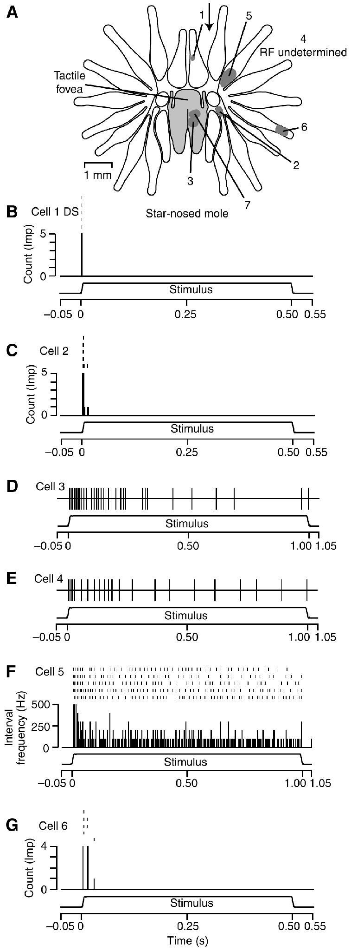
Peripheral afferents encode changing and held contact
Marasco and Catania recorded single sensory units from the trigeminal ganglion while controlled stimulators contacted the nose. Adaptation is a change in firing during continued stimulation, and their traces compare responses to a maintained mechanical indentation. Controlled stimulation places each unit under the same event. Firing is judged against a fixed stimulus.
Some receptors fired throughout the static portion, producing slowly adapting, Merkel-like responses. Others responded mainly to changing indentation, giving rapidly adapting profiles, and another rapidly adapting response produced a single onset impulse. Three response patterns therefore appear among the recorded units. All three patterns came from one preparation. The three types are distinct.
These classes provide complementary information about contact presence and contact change. Assignment to particular anatomical endings was based on response resemblance, so the link between each class and its terminal is an inference from response features. Holding contact and changing contact are signaled by different units. Holding and changing contact are coded separately.
Gerhold et al. (2013), Fig. 1(C–D). Original organ anatomy and NF200/substance-P labeling.
Marasco & Catania (2007), Fig. 4(A–G). Recorded receptor responses in star-nosed mole nasal afferents.
Marasco & Catania (2007); Gerhold et al. (2013)
21
Notes:
• Marasco and Catania recorded single sensory units from the trigeminal ganglion while controlled stimulators contacted the nose. Adaptation is a change in firing during continued stimulation. Their star-nosed mole traces compare responses to a maintained mechanical indentation rather than to freely chosen touches.
– A rapidly adapting neuron can remain highly sensitive while becoming silent during an unchanged indentation. Silence in that interval reflects the stimulus feature it encodes, rather than failure of the sensory preparation.
• Some receptors fired throughout the static portion, producing slowly adapting, Merkel-like responses. Others responded mainly to changing indentation, giving rapidly adapting profiles; another rapidly adapting response produced a single onset impulse. The illustrated traces distinguish these patterns during 500-ms stimulation.
• These classes provide complementary information about contact presence and contact change. Assignment to particular anatomical endings was based on response resemblance, not post-recording identification of every terminal. The recordings support multiple peripheral codes but do not establish their separate necessity for prey discrimination.
References:
Marasco PD, Catania KC (2007). Response properties of primary afferents supplying Eimer's organ. Journal of Experimental Biology 210(5):765-780. https://doi.org/10.1242/jeb.02690
Gerhold KA, Pellegrino M, Tsunozaki M, Morita T, Leitch DB, Tsuruda PR, Brem RB, Catania KC, Bautista DM (2013). The Star-Nosed Mole Reveals Clues to the Molecular Basis of Mammalian Touch. PLoS ONE 8(1):e55001. https://doi.org/10.1371/journal.pone.0055001
Figure: Marasco & Catania (2007), Fig. 4(A–G). Recorded receptor responses in star-nosed mole nasal afferents.
Figure source: https://doi.org/10.1242/jeb.02690
Figure: Gerhold et al. (2013), Fig. 1(C–D). Original organ anatomy and NF200/substance-P labeling.
Figure source: https://doi.org/10.1371/journal.pone.0055001

Slide 28
Rapidly adapting units go silent in steady contact
A rapidly adapting neuron can remain highly sensitive while becoming silent during an unchanged indentation. Silence in that interval reflects the stimulus feature the neuron encodes, rather than a failure of the sensory preparation. Figure 4(A–G) of Marasco and Catania (2007) shows recorded receptor responses in star-nosed mole nasal afferents.
The illustrated traces distinguish these response patterns during 500-ms stimulation, which is the duration of each indentation in the recordings. Slowly adapting units continued firing while the static part of the stimulus lasted, and rapidly adapting units responded when the indentation changed.
Matching responses to terminals relied on the resemblance of response features, with no post-recording identification of every ending. The recordings support multiple peripheral codes for contact, and they leave open whether each code is separately needed for prey discrimination.
Gerhold et al. (2013), Fig. 1(C–D). Original organ anatomy and NF200/substance-P labeling.
Marasco & Catania (2007), Fig. 4(A–G). Recorded receptor responses in star-nosed mole nasal afferents.
Marasco & Catania (2007)
21a
Notes:
• Rapidly adapting units go silent in steady contact.
• Explanation 1.
– A rapidly adapting neuron can remain highly sensitive while becoming silent during an unchanged indentation
– Silence in that interval reflects the stimulus feature the neuron encodes, rather than a failure of the sensory preparation. Figure 4(A–G) of Marasco and Catania (2007) shows recorded receptor responses in star-nosed mole nasal afferents.
• Explanation 2.
– The illustrated traces distinguish these response patterns during 500-ms stimulation, which is the duration of each indentation in the recordings
– Slowly adapting units continued firing while the static part of the stimulus lasted, and rapidly adapting units responded when the indentation changed.
• Explanation 3.
– Matching responses to terminals relied on the resemblance of response features, with no post-recording identification of every ending
– The recordings support multiple peripheral codes for contact, and they leave open whether each code is separately needed for prey discrimination.
• Source.
– The figure and the measurements come from Marasco & Catania (2007).
– Each statement is tied to the recordings or observations of that study.
References:
Marasco PD, Catania KC (2007). Response properties of primary afferents supplying Eimer's organ. Journal of Experimental Biology 210(5):765-780. https://doi.org/10.1242/jeb.02690

Slide 29
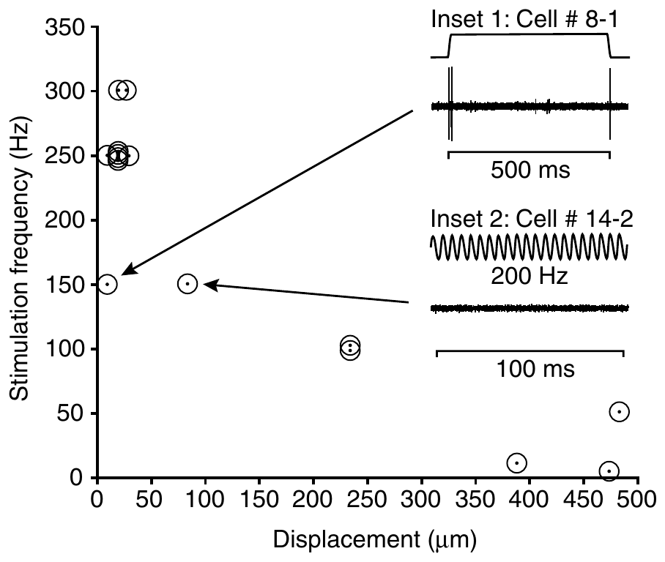
Vibration tuning distinguishes afferent response classes
Marasco and Catania varied sinusoidal indentation frequency and amplitude in coast-mole nasal afferents. A sinusoidal stimulus repeatedly moves the skin inward and outward, which tests receptor dynamics in Eimer's organs. Varying both frequency and amplitude shows how each unit responds across the range of mechanical input. Frequency and amplitude were varied together.
Pacinian-like rapidly adapting units were most active near 250–300 Hz at small displacements of about 10–28 µm. Other rapidly adapting units responded over broader ranges, roughly 5–150 Hz, especially at larger amplitudes, so frequency preference depends on receptor class and stimulus magnitude. Each class has its own range. Both ranges were measured at several amplitudes.
The results support parallel channels for distinct mechanical changes. The quantitative tuning measurements come from coast moles, while the star-nosed mole recordings established comparable response classes and left the tuning curves as a separate question. The classes are the common feature across the two species. The classes differ in their preferred inputs.
Marasco & Catania (2007), Fig. 5. Peak frequency and displacement sensitivity in coast-mole afferents.
Marasco et al. (2006), Fig. 5(A–C). NF200 and substance-P labeling in the coast mole.
Marasco & Catania (2007); Marasco et al. (2006)
22
Notes:
• Marasco and Catania varied sinusoidal indentation frequency and amplitude in coast-mole nasal afferents. A sinusoidal stimulus repeatedly moves the skin inward and outward. This comparative preparation tests receptor dynamics in Eimer’s organs without assuming that all mole species have identical tuning.
– A frequency peak is conditional on stimulus amplitude. Comparing two neurons at different amplitudes can confound frequency selectivity with their different indentation thresholds.
• Pacinian-like rapidly adapting units were most active near 250–300 Hz at relatively small displacements of about 10–28 µm. Other rapidly adapting units responded over broader ranges, approximately 5–150 Hz, especially at larger displacement amplitudes. Frequency preference therefore depended on receptor class and stimulus magnitude.
• The results support parallel channels for distinct mechanical changes. These quantitative tuning measurements mainly concern coast moles; the star-nosed mole recordings established comparable response classes but not identical tuning curves. The putative anatomical assignments remain hypotheses because the recorded axons were not individually traced to terminal types.
References:
Marasco PD, Catania KC (2007). Response properties of primary afferents supplying Eimer's organ. Journal of Experimental Biology 210(5):765-780. https://doi.org/10.1242/jeb.02690
Marasco PD, Tsuruda PR, Bautista DM, Julius D, Catania KC (2006). Neuroanatomical evidence for segregation of nerve fibers conveying light touch and pain sensation in Eimer’s organ of the mole. Proceedings of the National Academy of Sciences 103(24):9339-9344. https://doi.org/10.1073/pnas.0603229103
Figure: Marasco & Catania (2007), Fig. 5. Peak frequency and displacement sensitivity in coast-mole afferents.
Figure source: https://doi.org/10.1242/jeb.02690
Figure: Marasco et al. (2006), Fig. 5(A–C). NF200 and substance-P labeling in the coast mole.
Figure source: https://doi.org/10.1073/pnas.0603229103

Slide 30
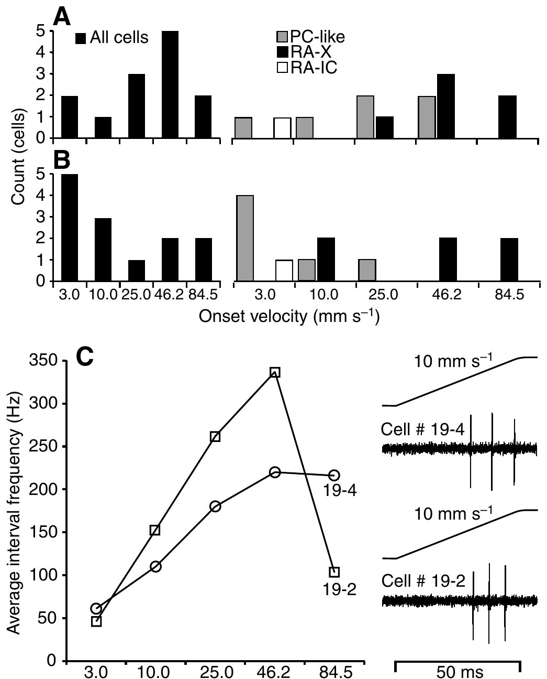
Some afferents respond best at natural contact speeds
Marasco and Catania tested ramp indentations in coast-mole afferents, changing onset speed while holding displacement at 500 µm. Indentation velocity describes how quickly the probe moves into the skin, separate from final depth and the duration of maintained contact. Holding displacement fixed isolates speed as the variable being tested. Ramp stimuli reach the same displacement at every speed.
The tested speeds reached 84.5 mm/s. One velocity, 46.2 mm/s, matched the measured nose speed during foraging, and some rapidly adapting units followed every stimulus at that speed. The speed range therefore spans both slow and fast movement of the nose. Both slow and fast ramps were included in the series. Speeds below that value were also tested.
The findings support sensitivity to the temporal mechanics of natural sampling. Two units changed firing non-monotonically as velocity increased, so skin geometry and afferent class both shape how probe movement becomes neural discharge. A unit's preferred speed can differ from the fastest stimulus it receives. Each unit's preferred velocity is part of its response profile.
Marasco et al. (2006), Fig. 5(A–C). NF200 and substance-P labeling in the coast mole.
Marasco & Catania (2007), Fig. 7(A–C). Coast-mole afferent responses to indentation velocity.
Marasco & Catania (2007); Marasco et al. (2006)
23
Notes:
• Marasco and Catania tested ramp indentations in coast-mole afferents, changing onset speed while holding displacement at 500 µm. Indentation velocity describes how quickly the probe moves into the skin; it is separate from the final indentation depth and the duration of maintained contact.
– Keeping displacement constant makes velocity the intended variable. A higher spike count at one speed can still reflect that receptor’s mechanical filtering rather than an abstract neural representation of speed.
• The tested speeds extended to 84.5 mm/s. One velocity, 46.2 mm/s, matched the measured nose speed during foraging. Some rapidly adapting units followed every stimulus at this speed; two units changed firing non-monotonically as velocity increased rather than simply preferring the fastest ramp.
• The findings support sensitivity to the temporal mechanics of natural sampling. They do not prove evolutionary tuning to a unique optimal velocity or establish the same numerical preferences in star-nosed moles. Skin geometry, preparation and afferent class can all influence the relationship between probe movement and neural discharge.
References:
Marasco PD, Catania KC (2007). Response properties of primary afferents supplying Eimer's organ. Journal of Experimental Biology 210(5):765-780. https://doi.org/10.1242/jeb.02690
Marasco PD, Tsuruda PR, Bautista DM, Julius D, Catania KC (2006). Neuroanatomical evidence for segregation of nerve fibers conveying light touch and pain sensation in Eimer’s organ of the mole. Proceedings of the National Academy of Sciences 103(24):9339-9344. https://doi.org/10.1073/pnas.0603229103
Figure: Marasco & Catania (2007), Fig. 7(A–C). Coast-mole afferent responses to indentation velocity.
Figure source: https://doi.org/10.1242/jeb.02690
Figure: Marasco et al. (2006), Fig. 5(A–C). NF200 and substance-P labeling in the coast mole.
Figure source: https://doi.org/10.1073/pnas.0603229103

Slide 31
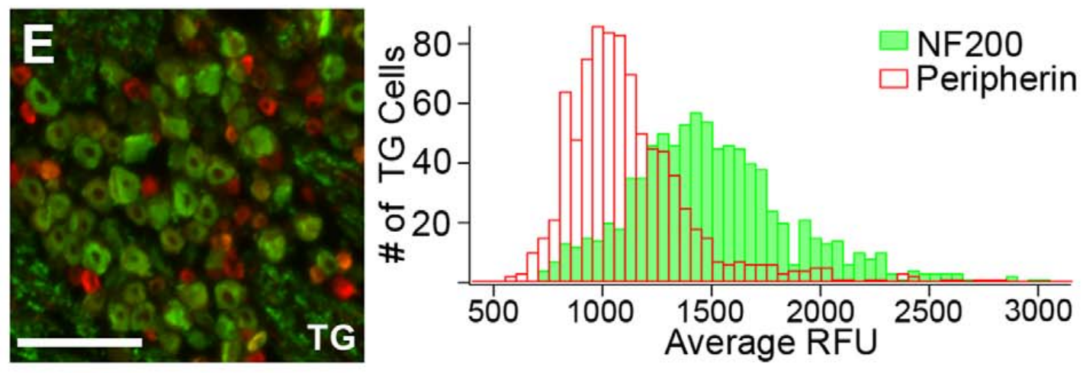
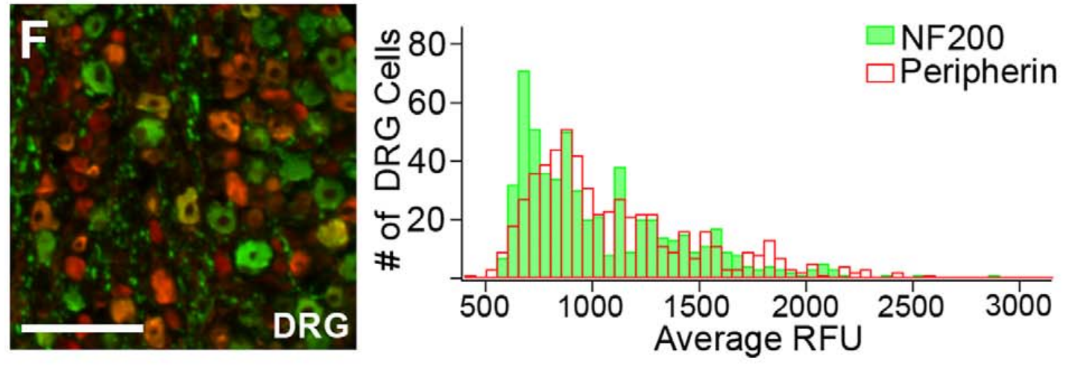
The trigeminal ganglion favors touch-associated neurons
The trigeminal ganglion, or TG, contains sensory-neuron cell bodies serving the face, while dorsal root ganglia, or DRG, serve the body. Gerhold and colleagues compared these tissues in star-nosed moles using NF200 and peripherin, a marker of many small sensory neurons. Both ganglia were examined in the same animals. Peripherin labels a population of small neurons.
About 57% of TG neurons labeled for NF200 and 13% for peripherin. In DRG, the corresponding proportions were about 36% and 35%, so the face-associated ganglion has a different neuronal composition within the same animal. The contrast is largest for NF200, the marker of large myelinated fibers. The two markers reveal different proportions in each ganglion.
The enrichment supports specialization of the input population supplying the star. Immunolabeling motivates physiological tests, since the TG also supplies facial tissues beyond the star. Physiological testing of these labeled populations is the logical follow-up. The ganglion differences are population-level findings, so each one needs a cell-level test. Each population could be tested in turn.
Gerhold et al. (2013), Fig. 1(E). Trigeminal-ganglion labeling and cell fluorescence distributions.
Gerhold et al. (2013), Fig. 1(F). Dorsal-root-ganglion labeling and cell fluorescence distributions.
Gerhold et al. (2013)
24
Notes:
• The trigeminal ganglion, or TG, contains sensory-neuron cell bodies serving the face. Dorsal root ganglia, or DRG, serve the body. Gerhold and colleagues compared these tissues in star-nosed moles using NF200 and peripherin, a marker associated with many small sensory neurons.
– A ganglion contains cell bodies outside the brain. Differences in this population can change what kinds of signals enter central pathways before cortical magnification occurs.
• About 57% of TG neurons labeled for NF200 and 13% for peripherin. In DRG, the corresponding proportions were about 36% and 35%. Thus the face-associated ganglion had a different neuronal composition from the body-associated comparison tissue within the same animal.
• The enrichment supports specialization of the input population supplying the star, rather than peripheral branching alone. Marker-defined groups are not exhaustive functional categories, and the TG supplies facial tissues beyond the star. Immunolabeling therefore motivates physiological tests instead of establishing a unique function for every labeled neuron.
References:
Gerhold KA, Pellegrino M, Tsunozaki M, Morita T, Leitch DB, Tsuruda PR, Brem RB, Catania KC, Bautista DM (2013). The Star-Nosed Mole Reveals Clues to the Molecular Basis of Mammalian Touch. PLoS ONE 8(1):e55001. https://doi.org/10.1371/journal.pone.0055001
Figure: Gerhold et al. (2013), Fig. 1(E). Trigeminal-ganglion labeling and cell fluorescence distributions.
Figure source: https://doi.org/10.1371/journal.pone.0055001
Figure: Gerhold et al. (2013), Fig. 1(F). Dorsal-root-ganglion labeling and cell fluorescence distributions.
Figure source: https://doi.org/10.1371/journal.pone.0055001

Slide 32
Ganglion makeup shapes incoming signals
A ganglion contains sensory cell bodies outside the brain, so its neuron types determine which signals enter central pathways. Differences in that population can change what the brain receives before cortical magnification occurs. The trigeminal ganglion serves the face, while the dorsal root ganglia serve the body, and both were sampled in the same animals.
NF200 labels many large, myelinated sensory fibers, while peripherin labels many small sensory neurons. Figure 1(E) and Figure 1(F) of the study show the trigeminal and dorsal root ganglion labeling alongside their cell fluorescence distributions. Each marker's proportions were reported separately for the two ganglia.
Marker-defined groups are not exhaustive functional categories. Gerhold and colleagues used these markers to choose candidate populations for physiological tests, because facial tissues other than the star also receive input from that ganglion. Cultured neurons from these ganglia were then tested with mechanical and chemical stimuli.
Gerhold et al. (2013), Fig. 1(E). Trigeminal-ganglion labeling and cell fluorescence distributions.
Gerhold et al. (2013), Fig. 1(F). Dorsal-root-ganglion labeling and cell fluorescence distributions.
Gerhold et al. (2013)
24a
Notes:
• Ganglion makeup shapes incoming signals.
• Explanation 1.
– A ganglion contains sensory cell bodies outside the brain, so its neuron types determine which signals enter central pathways
– Differences in that population can change what the brain receives before cortical magnification occurs. The trigeminal ganglion serves the face, while the dorsal root ganglia serve the body, and both were sampled in the same animals.
• Explanation 2.
– NF200 labels many large, myelinated sensory fibers, while peripherin labels many small sensory neurons
– Figure 1(E) and Figure 1(F) of the study show the trigeminal and dorsal root ganglion labeling alongside their cell fluorescence distributions. Each marker's proportions were reported separately for the two ganglia.
• Explanation 3.
– Marker-defined groups are not exhaustive functional categories
– Gerhold and colleagues used these markers to choose candidate populations for physiological tests, because facial tissues other than the star also receive input from that ganglion. Cultured neurons from these ganglia were then tested with mechanical and chemical stimuli.
• Source.
– The figure and the measurements come from Gerhold et al. (2013).
– Each statement is tied to the recordings or observations of that study.
References:
Gerhold KA, Pellegrino M, Tsunozaki M, Morita T, Leitch DB, Tsuruda PR, Brem RB, Catania KC, Bautista DM (2013). The Star-Nosed Mole Reveals Clues to the Molecular Basis of Mammalian Touch. PLoS ONE 8(1):e55001. https://doi.org/10.1371/journal.pone.0055001

Slide 33
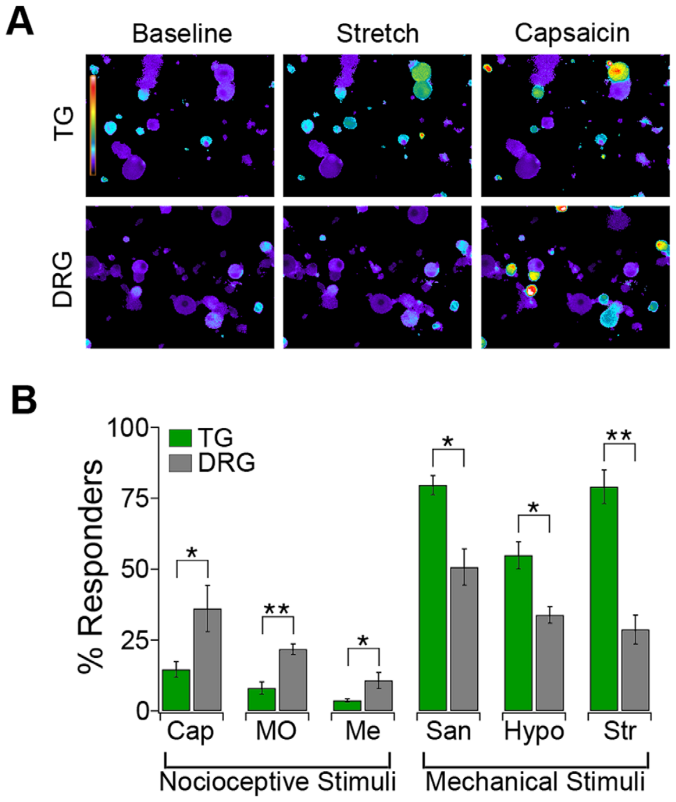
Stretch activates many cultured facial sensory neurons
Gerhold and colleagues isolated TG and DRG neurons and monitored intracellular calcium with Fura-2, a fluorescent calcium indicator. Neurons were cultured on deformable substrates, which allowed a 10% radial stretch to be applied to each tissue under a shared protocol. Both tissues received the same mechanical stimulus. Cells from each tissue were tested under identical conditions.
Approximately 80% of TG neurons responded to stretch, while 34% of DRG neurons did. The original images keep the authors' calcium-response colors, which mark the cells that responded. The responding fraction is much larger in the facial ganglion than in the body ganglion. The DRG fraction is therefore less than half the TG fraction.
This functional enrichment agrees with the greater fraction of touch-associated markers in the facial ganglion. Cultured-cell deformation removes the capsule, epidermis and receptor geometry, so a calcium rise reports cellular activation. The calcium signal therefore tracks activation of the whole cell rather than one channel. Cell-level calcium responses are a functional readout.
Gerhold et al. (2013), Fig. 2(A–B). Calcium images and responses to mechanical and chemical stimuli.
Gerhold et al. (2013)
25
Notes:
• Gerhold and colleagues isolated TG and DRG neurons and monitored intracellular calcium with Fura-2, a fluorescent calcium indicator. Neurons were cultured on deformable substrates, allowing a 10% radial stretch to be compared between tissues under a shared mechanical stimulation protocol.
– Calcium imaging can compare responsive fractions while leaving the initial transduction channel unresolved. Mechanical activation may recruit additional conductances before calcium increases enough to be detected.
• Approximately 80% of TG neurons responded to stretch, compared with 34% of DRG neurons. The original images retain the authors’ calcium-response colors. This functional enrichment agrees with the greater fraction of touch-associated markers in the facial ganglion.
• Cultured-cell deformation removes the intact organ’s capsule, epidermis and receptor geometry. A calcium rise reports cellular activation rather than the exact mechanically gated current or the number of propagated spikes. The comparison supports a mechanosensitive neuronal population, but does not directly measure tactile acuity in an exploring mole.
References:
Gerhold KA, Pellegrino M, Tsunozaki M, Morita T, Leitch DB, Tsuruda PR, Brem RB, Catania KC, Bautista DM (2013). The Star-Nosed Mole Reveals Clues to the Molecular Basis of Mammalian Touch. PLoS ONE 8(1):e55001. https://doi.org/10.1371/journal.pone.0055001
Figure: Gerhold et al. (2013), Fig. 2(A–B). Calcium images and responses to mechanical and chemical stimuli.
Figure source: https://doi.org/10.1371/journal.pone.0055001

Slide 34
Chemical and mechanical sensitivity differ by ganglion
Gerhold and colleagues challenged cultured TG and DRG neurons with mechanical stimuli and chemical agonists. An agonist activates a receptor or channel, and capsaicin targets TRPV1, mustard oil targets TRPA1 and menthol targets TRPM8. Each agonist probes a different channel in the same cultured cells. Every agonist was tested on the same cell cultures.
Capsaicin activated about 15% of TG neurons but 36% of DRG neurons. Mechanical stretch, hypotonic solution and hydroxy-alpha-sanshool activated greater fractions in TG, and a hypotonic solution can deform cells as water enters them. The mechanical stimuli therefore reveal the facial ganglion's larger mechanosensitive share. These responses show which stimuli each ganglion favors.
The results support a sensory trade-off favoring facial mechanosensitivity over several chemical sensitivities. Some TG neurons responded to the chemical agonists, and the tested agonists cover selected pathways. The trade-off is a pattern across the tested neurons rather than a complete inventory of each neuron's sensitivities. The facial ganglion therefore leans toward mechanical responses.
Gerhold et al. (2013), Fig. 2(A–B). Calcium images and responses to mechanical and chemical stimuli.
Gerhold et al. (2013)
26
Notes:
• Gerhold and colleagues challenged cultured TG and DRG neurons with mechanical stimuli and chemical agonists. An agonist activates a receptor or channel. Capsaicin targets TRPV1, mustard oil targets TRPA1 and menthol targets TRPM8; these probes separate cellular sensitivities beyond anatomical marker labeling.
– TRP denotes a family of transient receptor potential ion channels. Their activation can depolarize a neuron, but a chemical sensitivity in culture does not identify that neuron’s complete natural stimulus range.
• Capsaicin activated about 15% of TG neurons but 36% of DRG neurons. Mechanical stretch, hypotonic solution and hydroxy-alpha-sanshool activated greater fractions in TG. A hypotonic solution has lower solute concentration and can deform cells as water enters them.
• The results support a sensory trade-off favoring facial mechanosensitivity over several chemical sensitivities. They do not show that the star lacks pain detection, because some TG neurons responded and the tested agonists cover only selected pathways. Dissociated cells also cannot identify how these signals guide natural feeding.
References:
Gerhold KA, Pellegrino M, Tsunozaki M, Morita T, Leitch DB, Tsuruda PR, Brem RB, Catania KC, Bautista DM (2013). The Star-Nosed Mole Reveals Clues to the Molecular Basis of Mammalian Touch. PLoS ONE 8(1):e55001. https://doi.org/10.1371/journal.pone.0055001
Figure: Gerhold et al. (2013), Fig. 2(A–B). Calcium images and responses to mechanical and chemical stimuli.
Figure source: https://doi.org/10.1371/journal.pone.0055001

Slide 35
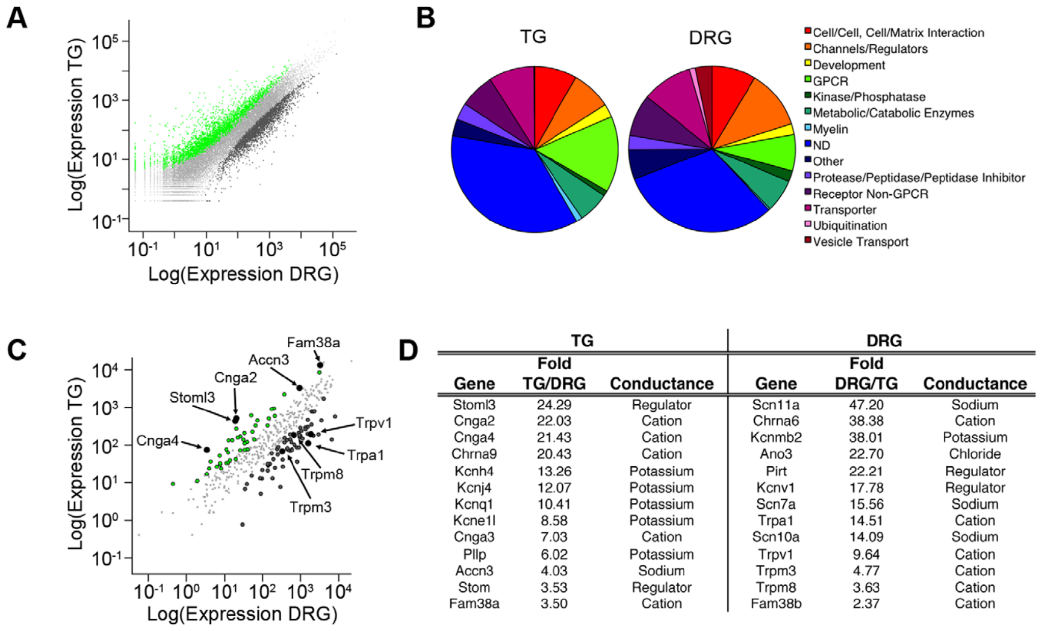
Transcript comparisons reveal molecular specialization
Gerhold and colleagues used RNA sequencing to measure expressed messenger RNAs in TG and DRG. A transcriptome is the collection of these RNA transcripts, and an annotated star-nosed mole genome was unavailable for alignment. The sequencing therefore had to use transcripts from other species as references. Many transcripts were measured in each ganglion.
Reads were aligned successively against human, dog and mouse transcript sequences, and the approach assigned approximately 42–65% of sequenced reads. Thousands of genes differed between the two mole ganglia. Successive alignment against several reference species gives more reads a chance to find a match. Reads that failed one reference went on to the next.
A parallel mouse TG–DRG comparison helped separate differences shared across mammals from those potentially linked to the mole's facial sensory population. This comparison identifies expression patterns rather than receptor function. The mouse comparison gives a second baseline for telling shared differences from species-specific ones. Shared differences can be set aside before the mole-specific ones are examined.
Gerhold et al. (2013), Fig. 3(A–D). Ganglion expression comparison, functional categories and channel candidates.
Gerhold et al. (2013)
27
Notes:
• Gerhold and colleagues used RNA sequencing to measure expressed messenger RNAs in TG and DRG. A transcriptome is the collection of these RNA transcripts. Because an annotated star-nosed mole genome was unavailable, reads were aligned successively against human, dog and mouse transcript sequences.
– RNA abundance is several steps removed from behavior: a transcript must produce protein, the protein must act in an appropriate cell, and its activity must contribute to a relevant sensory response.
• The approach assigned approximately 42–65% of sequenced reads. Thousands of genes differed between the two mole ganglia. A parallel mouse TG–DRG comparison helped separate differences shared across mammals from those potentially associated with the mole’s unusually specialized facial sensory population.
• This comparison identifies expression patterns, not receptor function. Incomplete cross-species alignment can miss divergent transcripts, and bulk tissue includes neurons and supporting cells. A higher transcript abundance can reflect more cells of one type rather than greater expression in each neuron.
References:
Gerhold KA, Pellegrino M, Tsunozaki M, Morita T, Leitch DB, Tsuruda PR, Brem RB, Catania KC, Bautista DM (2013). The Star-Nosed Mole Reveals Clues to the Molecular Basis of Mammalian Touch. PLoS ONE 8(1):e55001. https://doi.org/10.1371/journal.pone.0055001
Figure: Gerhold et al. (2013), Fig. 3(A–D). Ganglion expression comparison, functional categories and channel candidates.
Figure source: https://doi.org/10.1371/journal.pone.0055001

Slide 36
Transcript abundance is several steps from behavior
A transcript must be translated into protein, that protein must act in an appropriate cell, and its activity must contribute to a sensory response. Each of these steps is a place where the expression signal can be lost, so RNA abundance sits several steps from behavior. Bulk ganglion tissue adds supporting cells to the neurons being measured.
Reference transcripts from three other species were used to assemble the expression profiles. Figure 3(A–D) of the study shows the ganglion expression comparison, the functional categories and the channel candidates, and the same candidates were carried forward to qPCR tests.
The expression patterns nominate molecules for functional testing rather than assigning a complete transduction pathway. Reads that failed to match one reference species were passed to the next one in the series. Between 42% and 65% of sequenced reads received an assignment in this way.
Gerhold et al. (2013), Fig. 3(A–D). Ganglion expression comparison, functional categories and channel candidates.
Gerhold et al. (2013)
27a
Notes:
• Transcript abundance is several steps from behavior.
• Explanation 1.
– A transcript must be translated into protein, that protein must act in an appropriate cell, and its activity must contribute to a sensory response
– Each of these steps is a place where the expression signal can be lost, so RNA abundance sits several steps from behavior. Bulk ganglion tissue adds supporting cells to the neurons being measured.
• Explanation 2.
– Reference transcripts from three other species were used to assemble the expression profiles
– Figure 3(A–D) of the study shows the ganglion expression comparison, the functional categories and the channel candidates, and the same candidates were carried forward to qPCR tests.
• Explanation 3.
– The expression patterns nominate molecules for functional testing rather than assigning a complete transduction pathway
– Reads that failed to match one reference species were passed to the next one in the series. Between 42% and 65% of sequenced reads received an assignment in this way.
• Source.
– The figure and the measurements come from Gerhold et al. (2013).
– Each statement is tied to the recordings or observations of that study.
References:
Gerhold KA, Pellegrino M, Tsunozaki M, Morita T, Leitch DB, Tsuruda PR, Brem RB, Catania KC, Bautista DM (2013). The Star-Nosed Mole Reveals Clues to the Molecular Basis of Mammalian Touch. PLoS ONE 8(1):e55001. https://doi.org/10.1371/journal.pone.0055001

Slide 37
Expression nominates channels without proving causality
An ion channel is a membrane protein that permits ions to cross the cell membrane. Gerhold and colleagues focused their expression survey on channels and modulators, and facial-ganglion candidates included ASIC3, Piezo1, cyclic-nucleotide-gated channels and stomatin-related proteins. The survey narrowed the transcriptome to proteins that could shape electrical signals. They are channels or regulators.
DRG enrichment included TRPV1, TRPA1, TRPM8 and sodium-channel genes associated with nociceptive neurons. Piezo2 was also DRG-enriched in this dataset, so the enrichment divides mechanosensory candidates in a less tidy way across the two ganglia. Some known mechanosensors appear on the body side instead. The enrichment pattern is therefore uneven across the candidate list.
These results nominate molecules for functional testing, so the transduction pathway itself remains a hypothesis. Transferring a receptor's function from another species requires testing in the relevant cell type and context. The candidates are a starting list for experiments in the mole's own neurons. Each candidate needs a test in its own cell type.
Gerhold et al. (2013), Fig. 3(A–D). Ganglion expression comparison, functional categories and channel candidates.
Gerhold et al. (2013), Fig. 1(C–D). Original organ anatomy and NF200/substance-P labeling.
Gerhold et al. (2013)
28
Notes:
• An ion channel is a membrane protein that permits ions to cross the cell membrane. Gerhold and colleagues focused their expression comparison on channels and modulators. Facial-ganglion candidates included ASIC3, Piezo1, cyclic-nucleotide-gated channels and stomatin-related proteins.
– The published conductance table is retained as an original article panel. Channel enrichment and channel conductance are different properties: abundant expression does not determine the effect of opening the channel.
• DRG enrichment included TRPV1, TRPA1, TRPM8 and sodium-channel genes associated with nociceptive neurons. Piezo2 was also DRG-enriched in this dataset, despite its proposed mechanosensory role. Enrichment therefore did not divide every known mechanosensory candidate neatly into the facial ganglion.
• These results nominate molecules for functional testing rather than assigning a complete star transduction pathway. No targeted mole knockout established which candidate converts dome deformation into current. The unusual expression contrast also cautions against transferring a receptor’s function from another species without testing its cell type and context.
References:
Gerhold KA, Pellegrino M, Tsunozaki M, Morita T, Leitch DB, Tsuruda PR, Brem RB, Catania KC, Bautista DM (2013). The Star-Nosed Mole Reveals Clues to the Molecular Basis of Mammalian Touch. PLoS ONE 8(1):e55001. https://doi.org/10.1371/journal.pone.0055001
Figure: Gerhold et al. (2013), Fig. 3(A–D). Ganglion expression comparison, functional categories and channel candidates.
Figure source: https://doi.org/10.1371/journal.pone.0055001
Figure: Gerhold et al. (2013), Fig. 1(C–D). Original organ anatomy and NF200/substance-P labeling.
Figure source: https://doi.org/10.1371/journal.pone.0055001

Slide 38
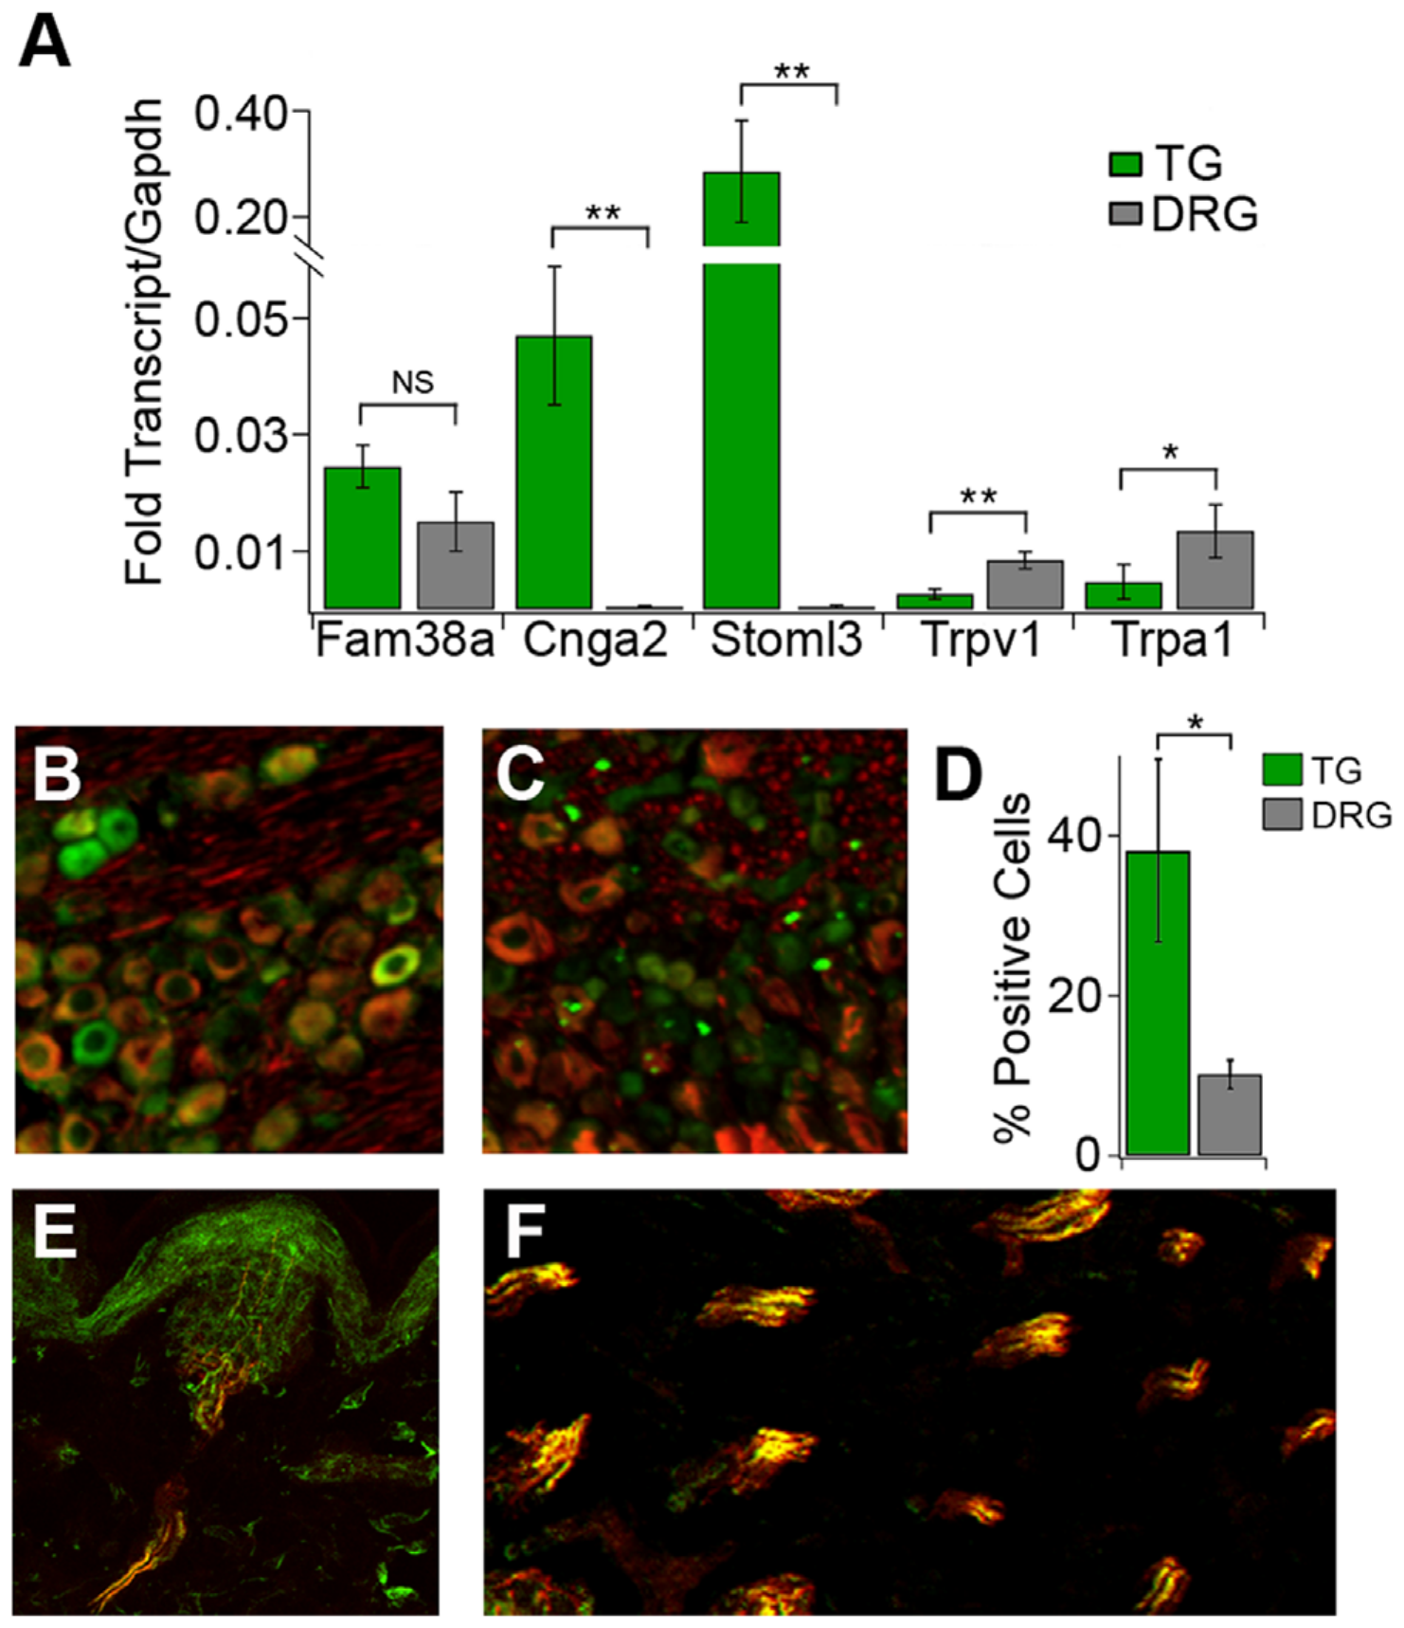
Independent assays qualify the expression screen
Quantitative PCR, or qPCR, measures selected RNA targets independently of a sequencing screen. Gerhold and colleagues tested several TG- and DRG-enriched candidates, normalizing each expression level to a reference transcript. Testing the same candidates with a second method checks the sequencing result. The qPCR step is an independent check of the screen.
Cnga2 and Stoml3 were more highly expressed in TG, whereas Trpa1 and Trpv1 were more highly expressed in DRG. Fam38a, the Piezo1 gene, followed the TG-directed trend, although that difference was less convincing in this assay. The qPCR results match the sequencing direction for most of the tested genes. Each value is normalized to the same reference.
Agreement across assays strengthens an expression claim while leaving function open. Expression measurements identify where RNA is abundant, and a stomatin-related protein may modulate a channel without forming the pore itself. Each candidate must therefore be followed up with a test of its activity. Expression evidence and functional evidence are therefore reported separately.
Gerhold et al. (2013), Fig. 4(A–F). Transcript validation and CNGA2 localization in ganglia and organs.
Gerhold et al. (2013)
29
Notes:
• Quantitative PCR, or qPCR, measures selected RNA targets independently of a sequencing screen. Gerhold and colleagues tested several TG- and DRG-enriched candidates, normalizing their expression to a reference transcript. Agreement across assays strengthens an expression claim while leaving function unresolved.
– A reference transcript supplies a common normalization baseline. It does not correct every possible difference in tissue composition, RNA preservation or cell-type abundance.
• Cnga2 and Stoml3 were more highly expressed in TG, whereas Trpa1 and Trpv1 were more highly expressed in DRG. Fam38a, the Piezo1 gene, followed the TG-directed trend but its qPCR difference was not established convincingly in this follow-up assay.
• The qualification prevents treating every sequencing candidate as independently confirmed. Expression measurements neither show that a channel is mechanically gated in the mole nor identify its physiological contribution. Stomatin-related proteins may modulate channels, so an enriched molecule need not itself form the pore carrying a transduction current.
References:
Gerhold KA, Pellegrino M, Tsunozaki M, Morita T, Leitch DB, Tsuruda PR, Brem RB, Catania KC, Bautista DM (2013). The Star-Nosed Mole Reveals Clues to the Molecular Basis of Mammalian Touch. PLoS ONE 8(1):e55001. https://doi.org/10.1371/journal.pone.0055001
Figure: Gerhold et al. (2013), Fig. 4(A–F). Transcript validation and CNGA2 localization in ganglia and organs.
Figure source: https://doi.org/10.1371/journal.pone.0055001

Slide 39
CNGA2 protein occurs in touch-associated cells
CNGA2 is a cyclic-nucleotide-gated channel subunit. Such channels respond to intracellular cyclic nucleotides, so expression alone is a weaker basis for mechanical detection. The protein's location in touch-associated cells is the evidence that matters here. The next check was whether the protein itself appears in mole ganglia. This check moves the evidence from RNA to protein.
Immunofluorescence revealed a larger fraction of CNGA2-positive cells in TG than DRG. These cells also displayed strong NF200 labeling, and in peripheral Eimer's-organ fibers more than 90% of CNGA2-positive profiles also labeled for NF200. The overlap ties the channel to the same fibers that carry touch-associated anatomy. Both observations come from the same tissue sections.
This provides spatial validation beyond a bulk RNA comparison. The result concerns protein localization, and it places the candidate within touch-associated anatomy. Protein staining is a direct check that the RNA signal reaches the cells that carry it. Protein localization is one level of the system, and the RNA screen is another.
Gerhold et al. (2013), Fig. 4(A–F). Transcript validation and CNGA2 localization in ganglia and organs.
Gerhold et al. (2013)
30
Notes:
• CNGA2 is a cyclic-nucleotide-gated channel subunit. Such channels can respond to intracellular cyclic nucleotides; expression does not make them automatically direct mechanical detectors. Gerhold and colleagues tested whether the RNA enrichment corresponded to detectable protein in star-nosed mole sensory ganglia.
– Co-labeling associates proteins with the same cellular profiles at the resolution of the assay. It does not establish a physical protein complex or direct interaction between CNGA2 and neurofilament.
• Immunofluorescence revealed a larger fraction of CNGA2-positive cells in TG than DRG. These cells also displayed strong NF200 labeling. In peripheral Eimer’s-organ fibers, more than 90% of CNGA2-positive profiles also labeled for NF200, linking the candidate to touch-associated anatomy.
• This provides spatial validation beyond a bulk RNA comparison. It remains evidence of protein localization, not a recorded CNGA2 current or a demonstrated requirement for prey capture. Antibody staining also cannot establish the complete channel-subunit composition or which intracellular pathway gates it during a touch.
References:
Gerhold KA, Pellegrino M, Tsunozaki M, Morita T, Leitch DB, Tsuruda PR, Brem RB, Catania KC, Bautista DM (2013). The Star-Nosed Mole Reveals Clues to the Molecular Basis of Mammalian Touch. PLoS ONE 8(1):e55001. https://doi.org/10.1371/journal.pone.0055001
Figure: Gerhold et al. (2013), Fig. 4(A–F). Transcript validation and CNGA2 localization in ganglia and organs.
Figure source: https://doi.org/10.1371/journal.pone.0055001

Slide 40
Co-labeling places proteins in the same profiles
Co-labeling places two proteins in the same cellular profiles at the resolution of the assay. Among fibers in the peripheral Eimer's organs, over nine in ten CNGA2-positive profiles carried NF200 labeling, which ties the candidate to touch-associated anatomy. Strong NF200 labeling appeared in the same cells.
A complete channel-subunit composition is a separate question from where a subunit is present in cells. The immunofluorescence result establishes protein localization, and a recorded CNGA2 current would be a different measurement made in different cells. Localizing one subunit tells nothing about the others present in the channel.
The intracellular pathway that gates the channel during a touch remains an open question. Protein presence in the right cells is the first step toward answering it, and the candidate still needs a functional test in those cells. Immunofluorescence was the method used for this check.
Gerhold et al. (2013), Fig. 4(A–F). Transcript validation and CNGA2 localization in ganglia and organs.
Gerhold et al. (2013)
30a
Notes:
• Co-labeling places proteins in the same profiles.
• Explanation 1.
– Co-labeling places two proteins in the same cellular profiles at the resolution of the assay
– Among fibers in the peripheral Eimer's organs, over nine in ten CNGA2-positive profiles carried NF200 labeling, which ties the candidate to touch-associated anatomy. Strong NF200 labeling appeared in the same cells.
• Explanation 2.
– A complete channel-subunit composition is a separate question from where a subunit is present in cells
– The immunofluorescence result establishes protein localization, and a recorded CNGA2 current would be a different measurement made in different cells. Localizing one subunit tells nothing about the others present in the channel.
• Explanation 3.
– The intracellular pathway that gates the channel during a touch remains an open question
– Protein presence in the right cells is the first step toward answering it, and the candidate still needs a functional test in those cells. Immunofluorescence was the method used for this check.
• Source.
– The figure and the measurements come from Gerhold et al. (2013).
– Each statement is tied to the recordings or observations of that study.
References:
Gerhold KA, Pellegrino M, Tsunozaki M, Morita T, Leitch DB, Tsuruda PR, Brem RB, Catania KC, Bautista DM (2013). The Star-Nosed Mole Reveals Clues to the Molecular Basis of Mammalian Touch. PLoS ONE 8(1):e55001. https://doi.org/10.1371/journal.pone.0055001

Slide 41
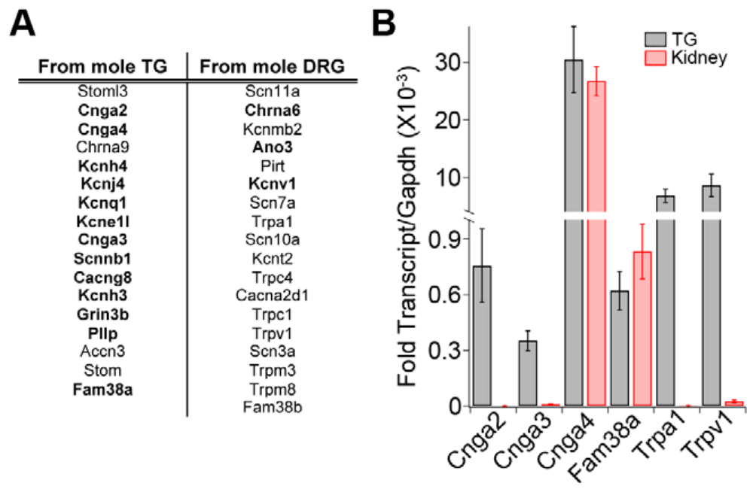
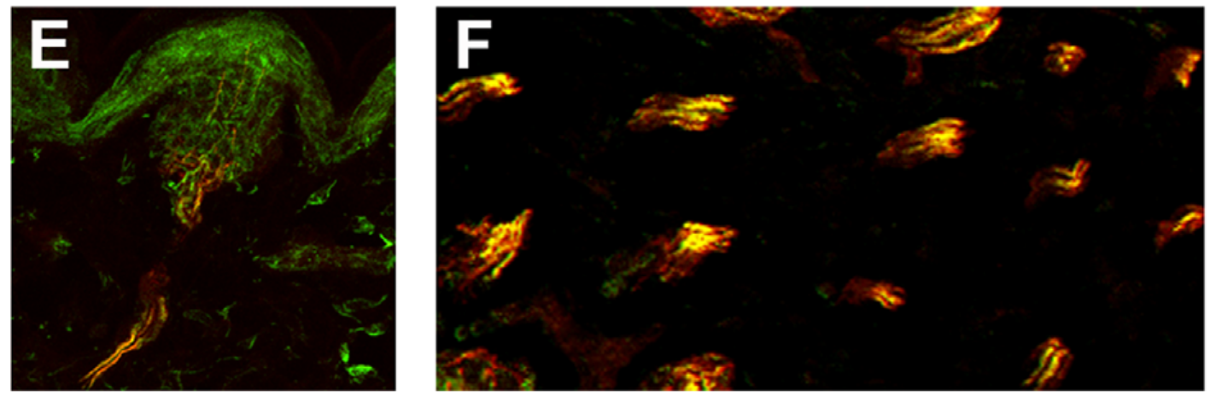
Cross-species tests retain candidates for functional work
Gerhold and colleagues examined candidate channels in mouse sensory ganglia using reverse-transcription PCR, which detects RNA after converting it to DNA. The mouse offered a more experimentally tractable system than the mole. The mouse comparison also made later experiments easier to design. Detection in mouse tissue is a practical route to later tests.
About 85% of the strongest mole ganglion-enriched channel candidates were detected in mouse TG and DRG. Additional qPCR confirmed expression of cyclic-nucleotide-gated subunits, Piezo1 and selected TRP channels, establishing their availability for further testing. The mouse detections place these channels in a species where experiments are easier to run. Both tissues were examined for each candidate.
The approach connects a specialized animal's molecular screen with possible mechanistic experiments. Species differences in receptor anatomy and neuronal composition still matter, even when an orthologous gene is present. Shared sequence identity permits comparisons while leaving species-specific expression and physiological roles open. Gene presence alone leaves function to be tested. Species differences need measuring.
Gerhold et al. (2013), Fig. 5(A–B). Candidate-channel detection in mouse sensory ganglia.
Gerhold et al. (2013), Fig. 4(E–F). CNGA2 and NF200 labeling in Eimer’s-organ fibers.
Gerhold et al. (2013)
31
Notes:
• Gerhold and colleagues examined candidate channels in mouse sensory ganglia using reverse-transcription PCR, which detects RNA after converting it to DNA. The mouse supplied a more experimentally tractable comparison, rather than a replacement measurement of the mole’s sensory behavior.
– An orthologous gene is a corresponding gene inherited from a common ancestor. Shared sequence identity permits comparisons while leaving species-specific expression and physiological roles open.
• About 85% of the strongest mole ganglion-enriched channel candidates were detected in mouse TG and DRG. Additional qPCR confirmed expression of cyclic-nucleotide-gated subunits, Piezo1 and selected TRP channels. Detection in both tissues established availability for further testing, not identical expression patterns across species.
• The approach connects a specialized animal’s molecular screen with possible mechanistic experiments. It does not show that mouse channels explain the mole’s tactile fovea or that expression causes cortical expansion. Species differences in receptor anatomy and neuronal composition remain relevant even when an orthologous gene is present.
References:
Gerhold KA, Pellegrino M, Tsunozaki M, Morita T, Leitch DB, Tsuruda PR, Brem RB, Catania KC, Bautista DM (2013). The Star-Nosed Mole Reveals Clues to the Molecular Basis of Mammalian Touch. PLoS ONE 8(1):e55001. https://doi.org/10.1371/journal.pone.0055001
Figure: Gerhold et al. (2013), Fig. 5(A–B). Candidate-channel detection in mouse sensory ganglia.
Figure source: https://doi.org/10.1371/journal.pone.0055001
Figure: Gerhold et al. (2013), Fig. 4(E–F). CNGA2 and NF200 labeling in Eimer’s-organ fibers.
Figure source: https://doi.org/10.1371/journal.pone.0055001

Slide 42
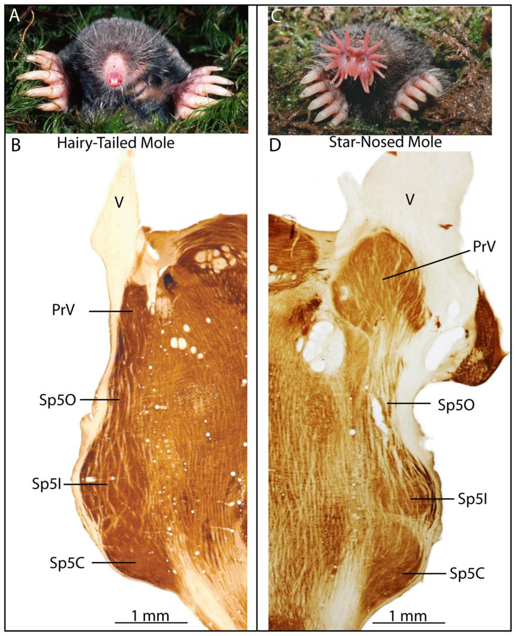
The principal trigeminal nucleus is enlarged
The principal trigeminal nucleus, or PrV, is a brainstem relay for facial mechanosensory input. Catania, Leitch and Gauthier compared stained brainstem sections from star-nosed and hairy-tailed moles, Parascalops breweri, relating central anatomy to their different nasal receptor surfaces. The hairy-tailed mole provides the ordinary reference. The species differ in nasal receptor surfaces.
PrV in the star-nosed mole was greatly expanded and bulged from the brainstem toward the incoming trigeminal nerve. Cytochrome-oxidase staining revealed strong internal subdivisions, and the adjacent spinal trigeminal complex served as an anatomical reference. The expansion is visible in the stained sections themselves. The expanded nucleus is therefore a feature of the star's anatomy.
The enlargement establishes a major specialization before signals reach the cortex. The study paired histology with receptive-field mapping, which tests whether the visible subdivisions represent specific rays. Central expansion therefore starts at the first relay after the trigeminal nerve. This relay is the first stage. Its subdivisions are visible in these sections.
Catania et al. (2011), Fig. 1(A–D). Facial anatomy and trigeminal nuclei in two mole species.
Catania et al. (2011)
32
Notes:
• The principal trigeminal nucleus, or PrV, is a brainstem relay for facial mechanosensory input. Catania, Leitch and Gauthier compared stained brainstem sections from star-nosed and hairy-tailed moles, Parascalops breweri, relating central anatomy to their different nasal receptor surfaces.
– Cytochrome oxidase is a metabolic enzyme used to reveal tissue organization. A darkly stained module is an anatomical compartment, not a direct quantitative recording of momentary neural activity.
• PrV in the star-nosed mole was greatly expanded and bulged from the brainstem toward the incoming trigeminal nerve. Cytochrome-oxidase staining revealed strong internal subdivisions. The adjacent spinal trigeminal complex provided an anatomical comparison rather than evidence that all facial nuclei expanded equally.
• The enlargement establishes a major specialization before signals reach cortex. Tissue size alone does not reveal individual synaptic strength, firing rate or the neurotransmitter responsible. The study combined histology with receptive-field mapping to determine whether the visible subdivisions actually represented specific rays.
References:
Catania KC, Leitch DB, Gauthier D (2011). A Star in the Brainstem Reveals the First Step of Cortical Magnification. PLoS ONE 6(7):e22406. https://doi.org/10.1371/journal.pone.0022406
Figure: Catania et al. (2011), Fig. 1(A–D). Facial anatomy and trigeminal nuclei in two mole species.
Figure source: https://doi.org/10.1371/journal.pone.0022406

Slide 43
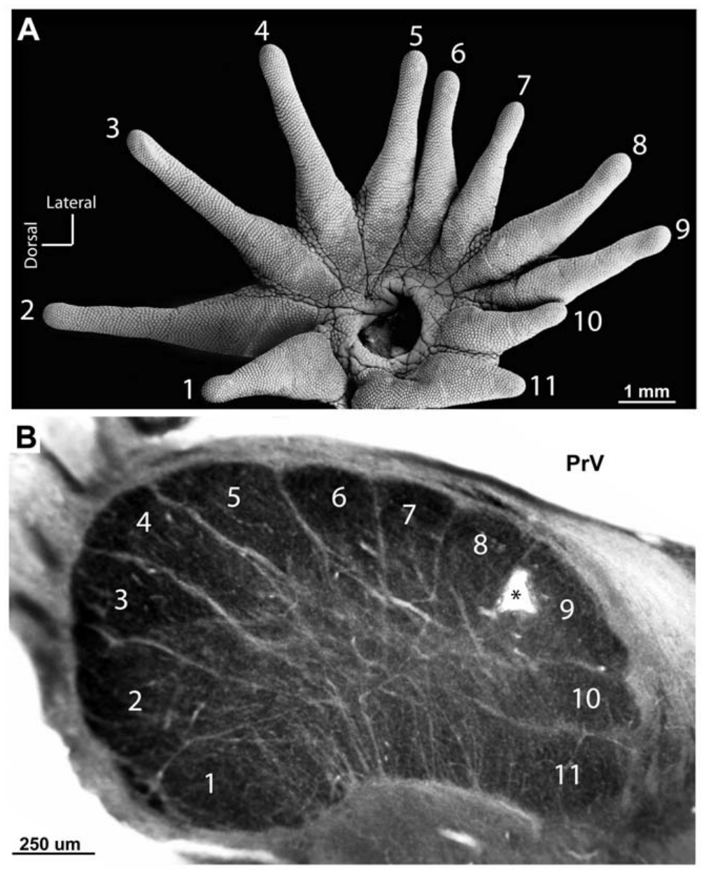
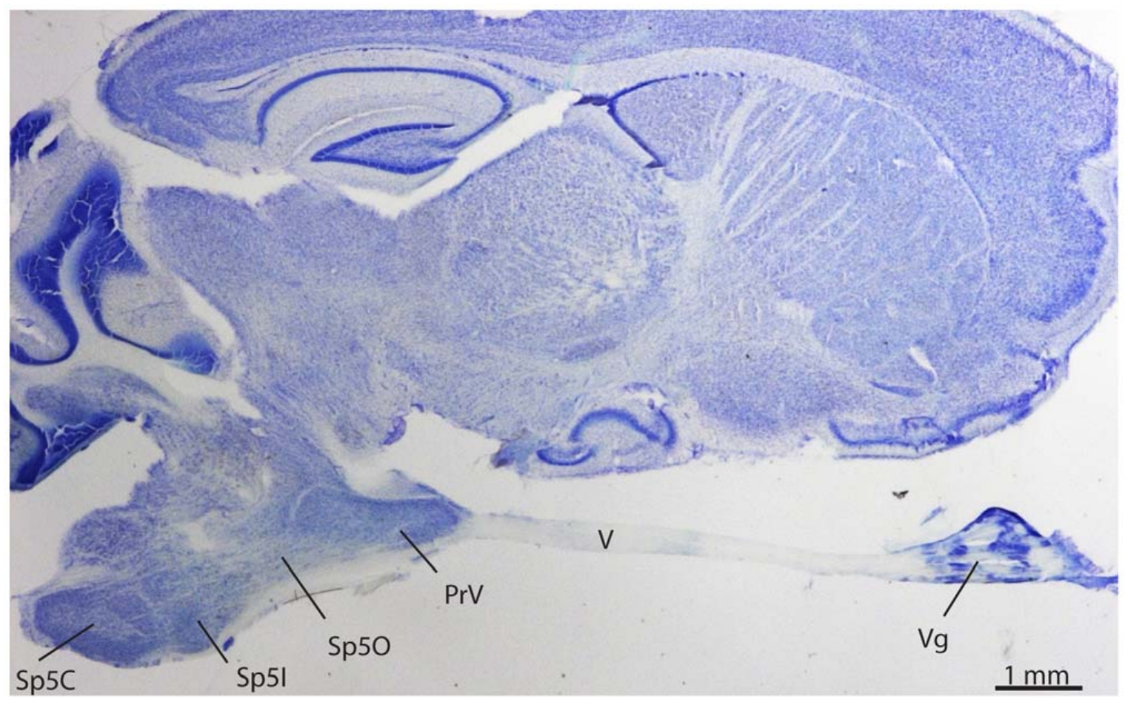
Eleven brainstem modules correspond to eleven rays
Somatotopy is an orderly relationship between positions on the body and their neural representations. Catania and colleagues sectioned PrV at an orientation that exposed its ray-related compartments. The orientation of the section decides which compartments appear together in one view. A map of this kind organizes the nucleus by ray identity. Each module's position reflects its ray.
Appropriately oriented sections revealed 11 modules corresponding to the 11 rays on one side of the nose. Ray 11 had a particularly large representation despite its small peripheral size, and the modules formed a star-like pattern. The pattern matches the arrangement of the rays around the nostril. The nose's arrangement is mirrored in the relay.
The histological pattern supports a topographic organization, and electrophysiology tested the assignments. The module correspondence depends on relating anatomy to responses from controlled stimulation. Anatomy alone gives a candidate map, and the recorded responses confirm it. Electrophysiology therefore gives the map its functional meaning. Each module is tested with stimulation of its ray.
Catania et al. (2011), Fig. 3(A–B). The star and its 11-module representation in PrV.
Catania et al. (2011), Fig. 2. Parasagittal section locating ganglion, nerve and trigeminal nuclei.
Catania et al. (2011)
33
Notes:
• Somatotopy is an orderly relationship between positions on the body and their neural representations. Catania and colleagues sectioned PrV at an orientation that exposed its ray-related compartments. The star’s separate peripheral rays supplied a natural set of identifiable sensory territories.
– The brainstem star is a map of ray identities. Its dimensions represent allocated neural tissue and need not preserve the physical dimensions of the skin.
• Appropriately oriented sections revealed 11 modules corresponding to the 11 rays on one side of the nose. Ray 11 had a particularly large representation despite its small peripheral size. The modules formed a star-like arrangement, but the tissue is a relay nucleus rather than a miniature physical nose.
• The histological pattern supports a topographic organization, and electrophysiology tested the assignments. A visible outline alone cannot distinguish local neurons from traversing axons or establish the precise projection to the next relay. The module correspondence depends on relating anatomy to responses from controlled stimulation.
References:
Catania KC, Leitch DB, Gauthier D (2011). A Star in the Brainstem Reveals the First Step of Cortical Magnification. PLoS ONE 6(7):e22406. https://doi.org/10.1371/journal.pone.0022406
Figure: Catania et al. (2011), Fig. 3(A–B). The star and its 11-module representation in PrV.
Figure source: https://doi.org/10.1371/journal.pone.0022406
Figure: Catania et al. (2011), Fig. 2. Parasagittal section locating ganglion, nerve and trigeminal nuclei.
Figure source: https://doi.org/10.1371/journal.pone.0022406

Slide 44
Brainstem star dimensions are neural allocation
The brainstem star's dimensions stand for allocated neural tissue, a quantity that differs from skin area. The sections were cut at an orientation that exposed the ray-related compartments, and the star-like pattern they show is a map of ray identities rather than a picture of the nose.
A visible outline alone leaves local neurons and traversing axons indistinguishable. Paired recordings with lesion marks link each recorded site to its ray and to its place in the PrV pattern. Cytochrome-oxidase staining made the internal subdivisions of the nucleus visible in the same sections.
Each of the 11 modules marks a territory of neural tissue for one ray. The modules form a star-like pattern inside a relay nucleus, which is a brainstem structure rather than a miniature nose. Module identity follows ray identity, so each module can be read as one ray's territory.
Catania et al. (2011), Fig. 3(A–B). The star and its 11-module representation in PrV.
Catania et al. (2011), Fig. 2. Parasagittal section locating ganglion, nerve and trigeminal nuclei.
Catania et al. (2011)
33a
Notes:
• Brainstem star dimensions are neural allocation.
• Explanation 1.
– The brainstem star's dimensions stand for allocated neural tissue, a quantity that differs from skin area
– The sections were cut at an orientation that exposed the ray-related compartments, and the star-like pattern they show is a map of ray identities rather than a picture of the nose.
• Explanation 2.
– A visible outline alone leaves local neurons and traversing axons indistinguishable
– Paired recordings with lesion marks link each recorded site to its ray and to its place in the PrV pattern. Cytochrome-oxidase staining made the internal subdivisions of the nucleus visible in the same sections.
• Explanation 3.
– Each of the 11 modules marks a territory of neural tissue for one ray
– The modules form a star-like pattern inside a relay nucleus, which is a brainstem structure rather than a miniature nose. Module identity follows ray identity, so each module can be read as one ray's territory.
• Source.
– The figure and the measurements come from Catania et al. (2011).
– Each statement is tied to the recordings or observations of that study.
References:
Catania KC, Leitch DB, Gauthier D (2011). A Star in the Brainstem Reveals the First Step of Cortical Magnification. PLoS ONE 6(7):e22406. https://doi.org/10.1371/journal.pone.0022406

Slide 45
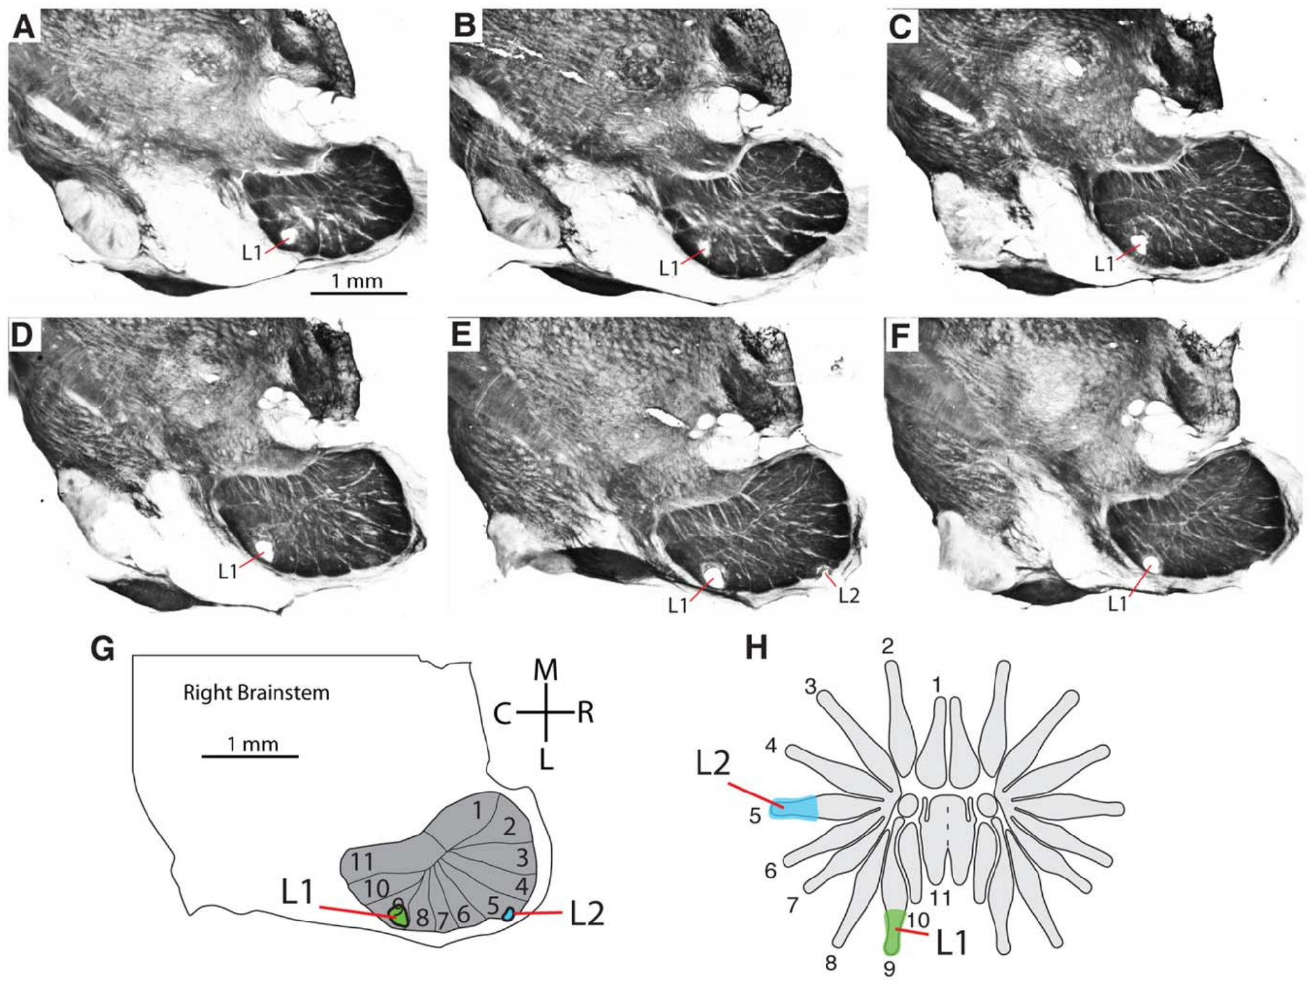
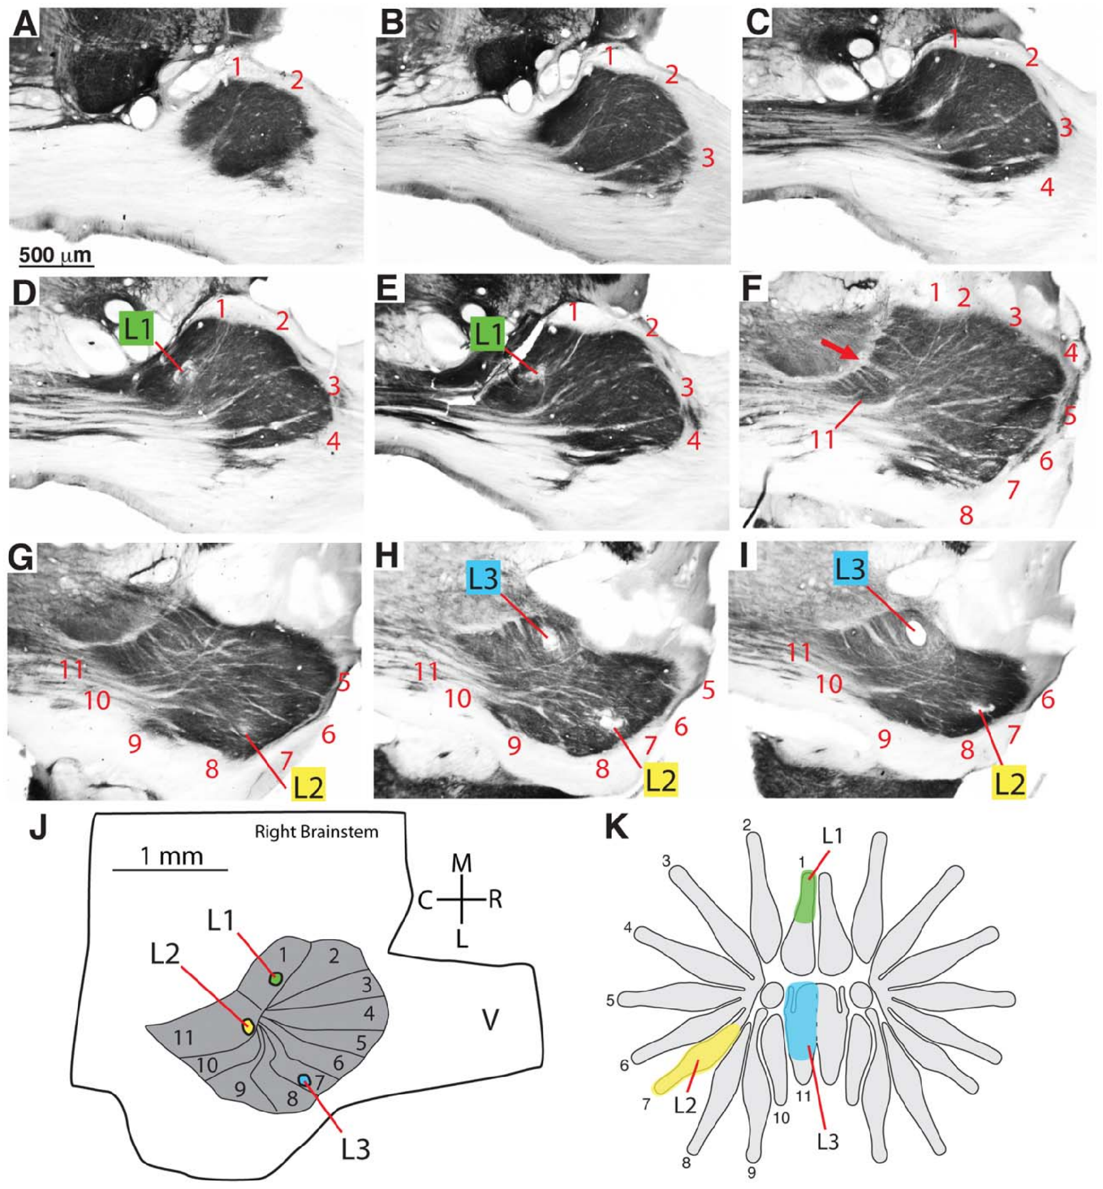
Recordings validate the brainstem ray assignments
Catania and colleagues recorded neural responses while gently stimulating identified nasal rays. They marked selected electrode locations with small lesions, then aligned these marks with stained sections. A receptive field is the peripheral region whose stimulation changes a recorded neuron's activity. The lesion marks make each recording traceable to its exact location.
Responses along each penetration changed according to the module entered. Lesion positions and serial sections related these functional assignments to the 11-module PrV pattern, which makes the paired record stronger than labeling modules by resemblance alone. The responses and the anatomy agree at each recorded site. The paired record therefore links each recorded site to a ray.
The results establish ray-related activity within PrV. Some penetrations also encountered trigeminal-nerve or spinal-nucleus responses, so the location of each penetration was checked anatomically. The check ties each penetration to its anatomical position. Each recording site was therefore assigned by both methods. The lesion marks and the sections together fix each site.
Catania et al. (2011), Fig. 4(A–H). Recording lesions linked to histology and ray receptive fields.
Catania et al. (2011), Fig. 5(A–K). Independent electrode tracks and ray assignments in PrV.
Catania et al. (2011)
34
Notes:
• Catania and colleagues recorded neural responses while gently stimulating identified nasal rays. They marked selected electrode locations with small lesions, then aligned these marks with stained sections. A receptive field is the peripheral region whose stimulation changes a recorded neuron’s activity.
– A recording lesion marks the electrode’s position after physiological measurements. It is a localization tool here, rather than an experimental lesion used to measure a loss of feeding behavior.
• Responses encountered along penetrations changed according to the module entered. Lesion positions and serial sections related these functional assignments to the 11-module PrV pattern. The paired record of stimulation territory and recording location is stronger evidence than labeling modules from resemblance alone.
• The results establish ray-related activity within PrV. Some penetrations also encountered trigeminal-nerve or spinal-nucleus responses, so location had to be checked anatomically. These experiments did not isolate every synaptic input or show that a given module is behaviorally necessary through selective inactivation.
References:
Catania KC, Leitch DB, Gauthier D (2011). A Star in the Brainstem Reveals the First Step of Cortical Magnification. PLoS ONE 6(7):e22406. https://doi.org/10.1371/journal.pone.0022406
Figure: Catania et al. (2011), Fig. 4(A–H). Recording lesions linked to histology and ray receptive fields.
Figure source: https://doi.org/10.1371/journal.pone.0022406
Figure: Catania et al. (2011), Fig. 5(A–K). Independent electrode tracks and ray assignments in PrV.
Figure source: https://doi.org/10.1371/journal.pone.0022406

Slide 46
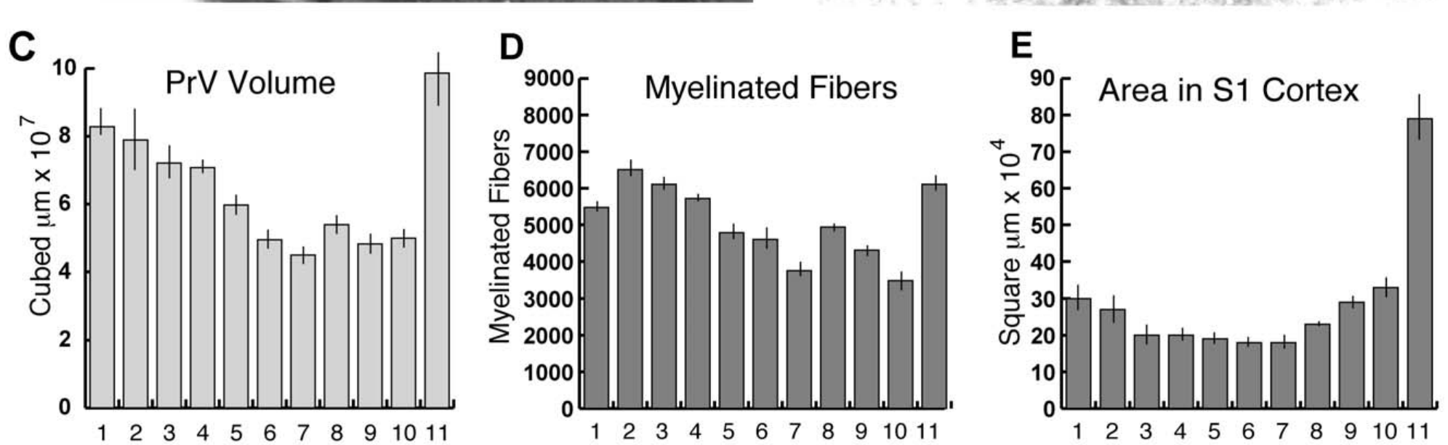
Foveal magnification increases beyond the brainstem
Catania and colleagues reconstructed serial PrV sections to measure each ray representation's volume. They then matched those volumes to previously measured myelinated-afferent counts and S1 cortical areas. The three measures together trace allocation from the nerve to the cortex. The measurements cover each stage of the pathway. Each stage contributes a different proportion of the star.
The reconstructed star subnucleus averaged about 7.1 mm³. Ray 11 supplied about 11% of the star's counted afferents, occupied 14% of its PrV representation and occupied 25% of the S1 star representation, so foveal investment increased across these stages. The increase at each stage is what makes the fovea a growing share of the map.
Across these stages, the allocation changes shape rather than scaling uniformly with the periphery. Proportions within each structure allow stages with different units to be compared, so the percentages carry the argument. Each stage stands on its own proportion of the star. Ray 11 is the reference point for each stage. Each ratio is a share of its own total.
Catania et al. (2011), Fig. 6(C–E). PrV volume, afferent counts and S1 allocation across rays.
Catania et al. (2011), Fig. 1(A–D). Facial anatomy and trigeminal nuclei in two mole species.
Catania et al. (2011)
35
Notes:
• Catania and colleagues reconstructed serial PrV sections to measure each ray representation’s volume. They compared these volumes with previously measured myelinated-afferent counts and S1 cortical areas. Magnification describes unequal allocation of neural tissue to different regions of the sensory surface.
– Comparing proportions within each structure avoids confusing cubic millimeters of brainstem with square millimeters of cortex. The measured percentages refer to the star representation, not the entire brain.
• The reconstructed star subnucleus averaged about 7.1 mm³. Ray 11 supplied about 11% of the star’s counted afferents, occupied 14% of its PrV representation and occupied 25% of the S1 star representation. Foveal investment therefore increased across these measured stages.
• The comparison establishes a distributional transformation rather than a uniform scaling of the periphery. Brainstem volume and cortical surface area have different units, so their absolute numerical values cannot be directly equated. Nor do these anatomical proportions identify where each additional synapse or neuron is added.
References:
Catania KC, Leitch DB, Gauthier D (2011). A Star in the Brainstem Reveals the First Step of Cortical Magnification. PLoS ONE 6(7):e22406. https://doi.org/10.1371/journal.pone.0022406
Figure: Catania et al. (2011), Fig. 6(C–E). PrV volume, afferent counts and S1 allocation across rays.
Figure source: https://doi.org/10.1371/journal.pone.0022406
Figure: Catania et al. (2011), Fig. 1(A–D). Facial anatomy and trigeminal nuclei in two mole species.
Figure source: https://doi.org/10.1371/journal.pone.0022406

Slide 47
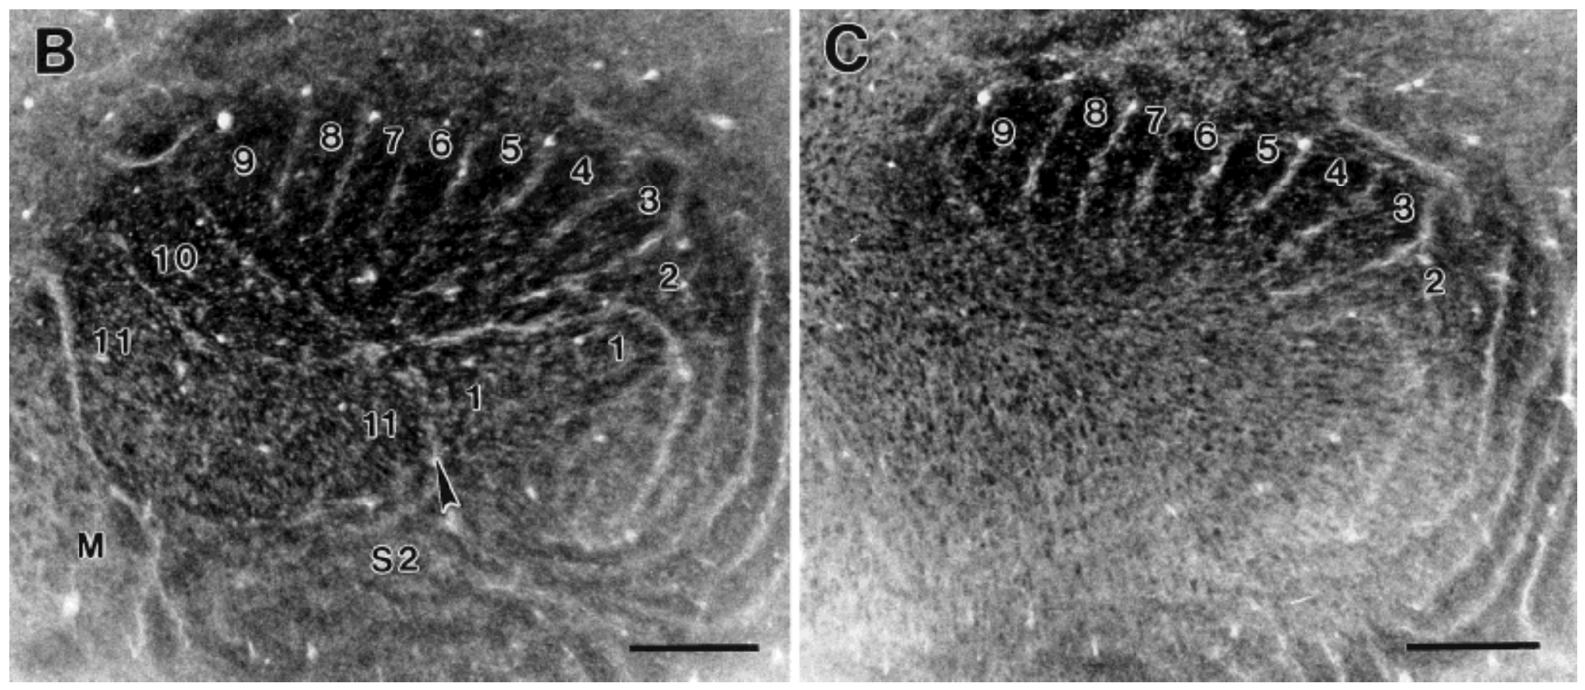
The cortical star consists of histological stripes
Primary somatosensory cortex, or S1, is a cortical area receiving somatic sensory information. Secondary somatosensory cortex, or S2, is another processing area with its own map. Catania and Kaas flattened cortex to expose its ray-related organization. Flattening brings the whole map into one view. Flattened cortex therefore gives a single map of the rays.
Cytochrome-oxidase processing revealed two pinwheel-like sets of stripes, corresponding to S1 and S2 star representations. Electrophysiological mapping associated the stripes with tactile input from rays on the opposite side of the nose, and the foveal ray occupied an especially large S1 territory. Each stripe set therefore carries a complete star map. These pinwheel sets are visible in one cortical sheet.
The visible stripes allow anatomical area to be set against peripheral innervation. The stripes imply interacting maps rather than isolated channels. Stripe boundaries let each ray's cortical area be measured directly. Its area can be read against the innervation counts for that ray. Stripe boundaries are defined by staining rather than by cell type.
Catania & Kaas (1997), Fig. 10(B–C). Cytochrome-oxidase stripes of S1 and S2 in flattened cortex.
Sawyer & Catania (2016), Fig. 1(A). The 22-ray tactile star.
Catania & Kaas (1997); Sawyer & Catania (2016)
36
Notes:
• Primary somatosensory cortex, or S1, is a cortical area receiving somatic sensory information. Secondary somatosensory cortex, or S2, is another processing area with its own map. Catania and Kaas flattened cortex and cut tangential sections to expose its ray-related organization.
– A tangential section runs approximately parallel to the cortical surface. Flattening makes the map easier to measure, while changing the tissue’s original three-dimensional configuration.
• Cytochrome-oxidase processing revealed two pinwheel-like sets of stripes, corresponding to S1 and S2 star representations. Electrophysiological mapping associated stripes with tactile input from rays on the opposite side of the nose. The foveal ray occupied an especially large S1 territory.
• The visible stripes allow anatomical area to be compared with measured peripheral innervation. They do not imply that cortex is divided into isolated channels without interaction. The staining also does not specify the neurotransmitters or ion channels used by neurons within a stripe; those require separate cellular experiments.
References:
Catania KC, Kaas JH (1997). Somatosensory fovea in the star-nosed mole: Behavioral use of the star in relation to innervation patterns and cortical representation. The Journal of Comparative Neurology 387(2):215-233. https://doi.org/10.1002/(sici)1096-9861(19971020)387:2<215::aid-cne4>3.0.co;2-3
Sawyer EK, Catania KC (2016). Somatosensory organ topography across the star of the star‐nosed mole (Condylura cristata). Journal of Comparative Neurology 524(5):917-929. https://doi.org/10.1002/cne.23943
Figure: Catania & Kaas (1997), Fig. 10(B–C). Cytochrome-oxidase stripes of S1 and S2 in flattened cortex.
Figure source: https://doi.org/10.1002/(sici)1096-9861(19971020)387:2<215::aid-cne4>3.0.co;2-3
Figure: Sawyer & Catania (2016), Fig. 1(A). The 22-ray tactile star.
Figure source: https://doi.org/10.1002/cne.23943

Slide 48
Stripe areas are measured on flattened cortex
A tangential section runs approximately parallel to the cortical surface, so cutting this way exposes a flat sheet of the map. Flattening makes the map easier to measure while changing the tissue's original three-dimensional configuration, and the S1 and S2 stripes both become visible in that sheet.
Figure 10(B–C) of Catania and Kaas (1997) shows the cytochrome-oxidase stripes of S1 and S2 in flattened cortex. Sawyer and Catania's Figure 1(A) shows the 22-ray tactile star whose rays these stripes represent. Electrophysiological mapping tied each stripe to tactile input from the contralateral side of the nose.
Dividing each S1 stripe's area by the number of incoming myelinated fibers gives cortical area per afferent. Ray 11 retained the largest value after this normalization, which distinguishes the foveal territory from the other rays. Cortical area per afferent was measured for each of the rays in the same study.
Catania & Kaas (1997), Fig. 10(B–C). Cytochrome-oxidase stripes of S1 and S2 in flattened cortex.
Sawyer & Catania (2016), Fig. 1(A). The 22-ray tactile star.
Catania & Kaas (1997)
36a
Notes:
• Stripe areas are measured on flattened cortex.
• Explanation 1.
– A tangential section runs approximately parallel to the cortical surface, so cutting this way exposes a flat sheet of the map
– Flattening makes the map easier to measure while changing the tissue's original three-dimensional configuration, and the S1 and S2 stripes both become visible in that sheet.
• Explanation 2.
– Figure 10(B–C) of Catania and Kaas (1997) shows the cytochrome-oxidase stripes of S1 and S2 in flattened cortex
– Sawyer and Catania's Figure 1(A) shows the 22-ray tactile star whose rays these stripes represent. Electrophysiological mapping tied each stripe to tactile input from the contralateral side of the nose.
• Explanation 3.
– Dividing each S1 stripe's area by the number of incoming myelinated fibers gives cortical area per afferent
– Ray 11 retained the largest value after this normalization, which distinguishes the foveal territory from the other rays. Cortical area per afferent was measured for each of the rays in the same study.
• Source.
– The figure and the measurements come from Catania & Kaas (1997).
– Each statement is tied to the recordings or observations of that study.
References:
Catania KC, Kaas JH (1997). Somatosensory fovea in the star-nosed mole: Behavioral use of the star in relation to innervation patterns and cortical representation. The Journal of Comparative Neurology 387(2):215-233. https://doi.org/10.1002/(sici)1096-9861(19971020)387:2<215::aid-cne4>3.0.co;2-3

Slide 49
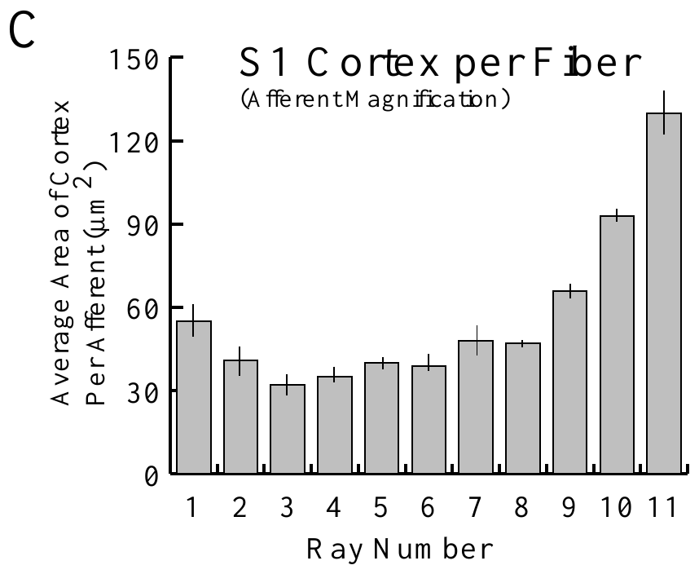
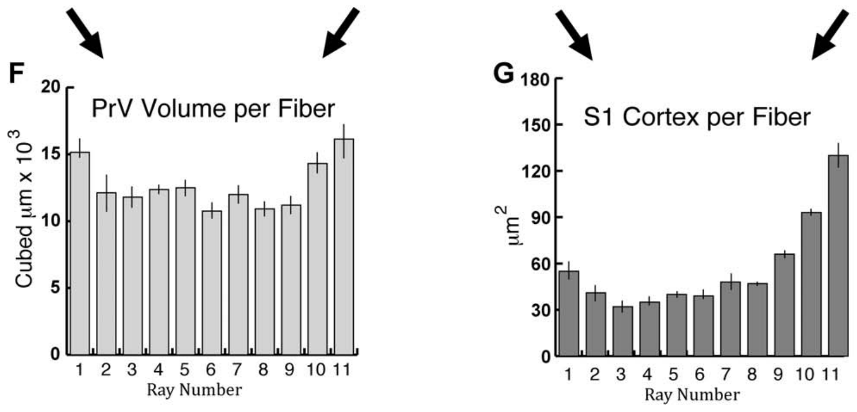
Afferent number does not fully explain cortical area
Catania and Kaas defined afferent magnification as cortical representational area per primary sensory afferent. They divided measured S1 ray territories by the corresponding myelinated-fiber counts, which differs from cortical area per skin area or per Eimer's organ. The measure asks how much cortex each incoming fiber receives. The denominator is the count of myelinated fibers.
Ray 11 retained the largest cortical allocation after normalization by afferent number. The later PrV analysis found a much smaller foveal excess at the brainstem stage, so the large S1 fovea reflects more than every incoming fiber receiving identical cortical space. The fovea gains cortical territory beyond what its input count predicts.
The result establishes unequal central investment per counted input. Myelinated counts omit other inputs, and cortical area measures representational space rather than processing capacity. Those two limits define how far the measure can be interpreted. The excess also varies with the stage at which it is measured. Cortical magnification is therefore stage-dependent.
Catania & Kaas (1997), Fig. 12(C). Cortical area per myelinated afferent across rays.
Catania et al. (2011), Fig. 6(F–G). Brainstem volume and S1 area per afferent.
Catania & Kaas (1997); Catania et al. (2011)
37
Notes:
• Catania and Kaas defined afferent magnification as cortical representational area per primary sensory afferent. They divided measured S1 ray territories by the corresponding myelinated-fiber counts. This differs from cortical area per skin area or per Eimer’s organ.
– Normalization asks whether a difference remains after accounting for a measured input variable. A remaining difference is evidence against that variable being the sole explanation; it does not identify the only alternative mechanism.
• Ray 11 retained the largest cortical allocation after normalization by afferent number. The later PrV analysis found a much smaller foveal excess at the brainstem stage. Thus the unusually large S1 fovea cannot be explained simply by every incoming fiber receiving identical cortical space.
• The result establishes unequal central investment per counted input, but not a complete causal mechanism. Myelinated counts omit other inputs, and cortical area does not directly measure processing capacity. The association with preferential behavioral use is consistent with functional specialization without proving that repeated use produced the map.
References:
Catania KC, Kaas JH (1997). Somatosensory fovea in the star-nosed mole: Behavioral use of the star in relation to innervation patterns and cortical representation. The Journal of Comparative Neurology 387(2):215-233. https://doi.org/10.1002/(sici)1096-9861(19971020)387:2<215::aid-cne4>3.0.co;2-3
Catania KC, Leitch DB, Gauthier D (2011). A Star in the Brainstem Reveals the First Step of Cortical Magnification. PLoS ONE 6(7):e22406. https://doi.org/10.1371/journal.pone.0022406
Figure: Catania & Kaas (1997), Fig. 12(C). Cortical area per myelinated afferent across rays.
Figure source: https://doi.org/10.1002/(sici)1096-9861(19971020)387:2<215::aid-cne4>3.0.co;2-3
Figure: Catania et al. (2011), Fig. 6(F–G). Brainstem volume and S1 area per afferent.
Figure source: https://doi.org/10.1371/journal.pone.0022406

Slide 50
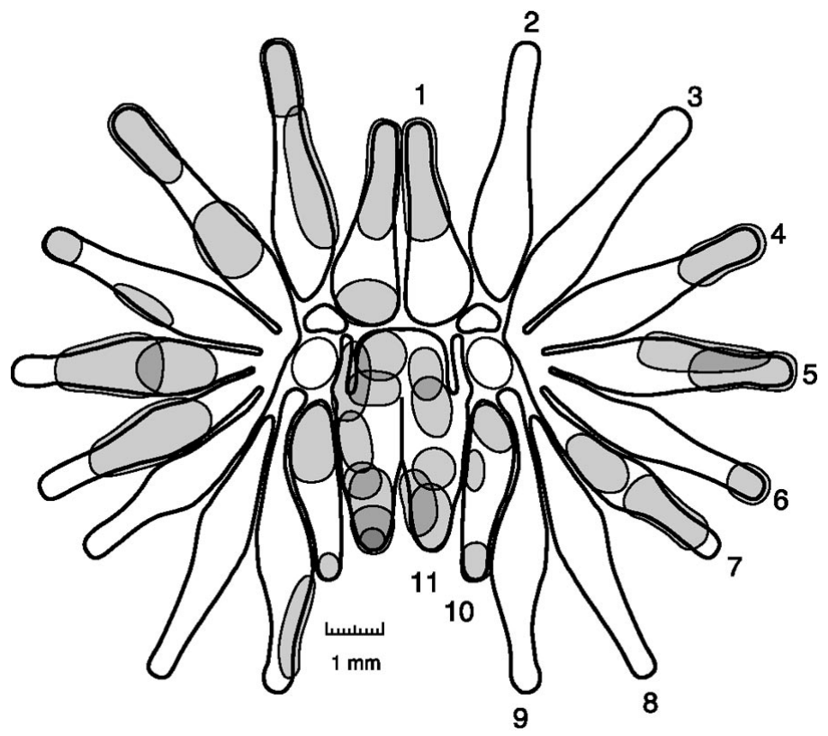
Foveal receptive fields are exceptionally small
Sachdev and Catania mapped excitatory receptive fields while recording multiunit activity in anesthetized moles. A fine glass probe contacted individual parts of the star under a microscope, and multiunit activity combines spikes from nearby neurons. Each mapped field is the region where contact drives that combined activity. Each field is therefore a measured boundary, not an anatomical one.
Mean excitatory field area was 0.59 mm² on ray 11 and 0.82 mm² on rays 1–10. Boundaries were sharply defined by the fall in evoked activity outside each field, and most fields occupied a continuous patch within one ray. The foveal fields are smaller than the fields on the other rays. The fields are reported as areas in square millimeters.
The smaller foveal fields support finer spatial sampling in the disproportionately large representation. Probe-based mapping depends on the contact region and on the criterion used to recognize a response, which sets how fields are measured. A smaller field gives a more precise location for each contact. Field size therefore reflects both anatomy and the recording criteria.
Sachdev & Catania (2002), Fig. 2. Measured multiunit receptive fields across the star.
Catania & Kaas (1997), Fig. 10(B–C). Cytochrome-oxidase stripes of S1 and S2 in flattened cortex.
Sachdev & Catania (2002); Catania & Kaas (1997)
38
Notes:
• Sachdev and Catania mapped excitatory receptive fields while recording multiunit activity in anesthetized moles. A fine glass probe contacted individual parts of the star under a microscope. Multiunit activity combines spikes from nearby neurons, so its field differs from a single isolated neuron’s field.
– A small receptive field means that local contact can activate a more restricted neuronal population. It does not by itself determine how reliably an animal discriminates two nearby objects.
• Mean excitatory field area was 0.59 mm² on ray 11 and 0.82 mm² on rays 1–10. Boundaries were sharply defined by the fall in evoked activity outside each field. Most fields occupied a continuous patch within one ray rather than spanning the whole star.
• The smaller foveal fields support finer spatial sampling in the disproportionately large representation. The measurements do not constitute a behavioral discrimination threshold, and anesthesia may alter network responses. Probe-based mapping also depends on the contact region and the criterion used to recognize a response.
References:
Sachdev RNS, Catania KC (2002). Receptive Fields and Response Properties of Neurons in the Star-Nosed Mole's Somatosensory Fovea. Journal of Neurophysiology 87(5):2602-2611. https://doi.org/10.1152/jn.2002.87.5.2602
Catania KC, Kaas JH (1997). Somatosensory fovea in the star-nosed mole: Behavioral use of the star in relation to innervation patterns and cortical representation. The Journal of Comparative Neurology 387(2):215-233. https://doi.org/10.1002/(sici)1096-9861(19971020)387:2<215::aid-cne4>3.0.co;2-3
Figure: Sachdev & Catania (2002), Fig. 2. Measured multiunit receptive fields across the star.
Figure source: https://doi.org/10.1152/jn.2002.87.5.2602
Figure: Catania & Kaas (1997), Fig. 10(B–C). Cytochrome-oxidase stripes of S1 and S2 in flattened cortex.
Figure source: https://doi.org/10.1002/(sici)1096-9861(19971020)387:2<215::aid-cne4>3.0.co;2-3

Slide 51
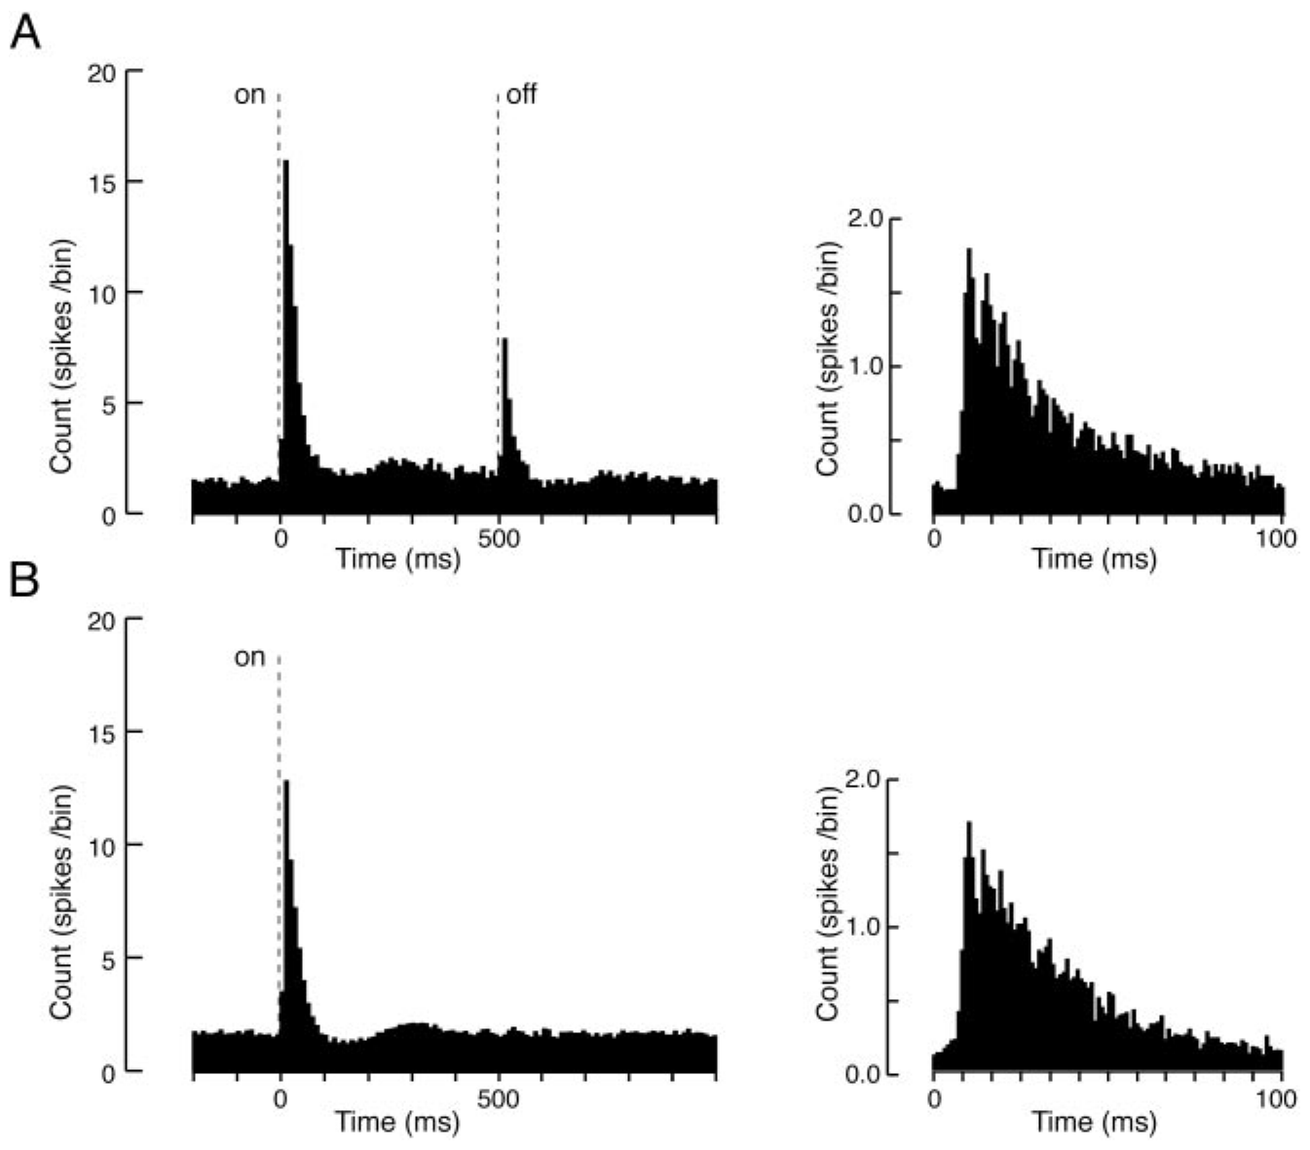
Controlled indentation separates contact from movement
Sachdev and Catania isolated cortical units and stimulated the mapped field with a piezoelectrically controlled probe. Piezoelectric actuation converts an applied voltage into a small mechanical displacement, and stimuli lasting 5 or 500 ms separated brief contact from a prolonged hold. A voltage applied to the probe sets its displacement. Each stimulus duration was delivered through that probe.
The probe was approximately 0.2–0.5 mm across and depressed the skin about 200 µm. Mean excitatory onset latency was 11.6 ms, similar for brief and prolonged stimuli. The probe's small size allowed it to contact a single part of the star. Stimuli were applied to the same mapped unit. Each response was measured against baseline spontaneous activity.
The common onset latency supports fast transmission whose timing is set by contact onset rather than total duration. The preparation controlled indentation rather than natural prey shape, and it recorded activity under anesthesia. The controlled probe makes the onset timing directly comparable across stimulus lengths. The measurement ties the response to the stimulus onset.
Sachdev & Catania (2002), Fig. 8(A–B). Population onset responses to 500-ms and 5-ms contact.
Catania & Kaas (1997), Fig. 10(B–C). Cytochrome-oxidase stripes of S1 and S2 in flattened cortex.
Sachdev & Catania (2002); Catania & Kaas (1997)
39
Notes:
• Sachdev and Catania isolated cortical units and stimulated the mapped field with a piezoelectrically controlled probe. Piezoelectric actuation converts an applied voltage into a small mechanical displacement. Stimuli lasting 5 or 500 ms separated brief contact from a prolonged hold.
– A poststimulus time histogram pools spike timing relative to stimulus onset. Its peak describes a response across trials; it should not be interpreted as every trial producing a spike at the same instant.
• The probe was approximately 0.2–0.5 mm across and depressed the skin about 200 µm. The authors recorded baseline spontaneous activity and compared responses at different locations. Mean excitatory onset latency was 11.6 ms, similar for brief and prolonged stimuli.
• The common onset latency supports fast transmission that is not simply determined by total contact duration. The preparation controlled indentation rather than natural prey shape, and recorded activity under anesthesia. It therefore constrains sensory timing without establishing the entire awake decision pathway or a particular transduction channel.
References:
Sachdev RNS, Catania KC (2002). Receptive Fields and Response Properties of Neurons in the Star-Nosed Mole's Somatosensory Fovea. Journal of Neurophysiology 87(5):2602-2611. https://doi.org/10.1152/jn.2002.87.5.2602
Catania KC, Kaas JH (1997). Somatosensory fovea in the star-nosed mole: Behavioral use of the star in relation to innervation patterns and cortical representation. The Journal of Comparative Neurology 387(2):215-233. https://doi.org/10.1002/(sici)1096-9861(19971020)387:2<215::aid-cne4>3.0.co;2-3
Figure: Sachdev & Catania (2002), Fig. 8(A–B). Population onset responses to 500-ms and 5-ms contact.
Figure source: https://doi.org/10.1152/jn.2002.87.5.2602
Figure: Catania & Kaas (1997), Fig. 10(B–C). Cytochrome-oxidase stripes of S1 and S2 in flattened cortex.
Figure source: https://doi.org/10.1002/(sici)1096-9861(19971020)387:2<215::aid-cne4>3.0.co;2-3

Slide 52
Population onset histograms pool many trials
A poststimulus time histogram pools spike timing relative to stimulus onset. Its peak describes responses across many trials, while spikes in individual trials fall at varying times around that peak, so the peak is a population summary rather than a timing rule for any single trial.
Figure 8(A–B) of Sachdev and Catania (2002) shows population onset responses to 500-ms and 5-ms contact. Each mapped site was measured against its own spontaneous activity before the stimulus, which provided the reference firing rate.
Mean latency measured 11.6 ms, with little difference between brief and prolonged stimulation. Brief and prolonged stimuli of 5 and 500 ms were delivered through the same piezoelectric probe, so onset timing can be compared across stimulus lengths.
Sachdev & Catania (2002), Fig. 8(A–B). Population onset responses to 500-ms and 5-ms contact.
Catania & Kaas (1997), Fig. 10(B–C). Cytochrome-oxidase stripes of S1 and S2 in flattened cortex.
Sachdev & Catania (2002)
39a
Notes:
• Population onset histograms pool many trials.
• Explanation 1.
– A poststimulus time histogram pools spike timing relative to stimulus onset
– Its peak describes responses across many trials, while spikes in individual trials fall at varying times around that peak, so the peak is a population summary rather than a timing rule for any single trial.
• Explanation 2.
– Figure 8(A–B) of Sachdev and Catania (2002) shows population onset responses to 500-ms and 5-ms contact
– Each mapped site was measured against its own spontaneous activity before the stimulus, which provided the reference firing rate.
• Explanation 3.
– Mean latency measured 11.6 ms, with little difference between brief and prolonged stimulation
– Brief and prolonged stimuli of 5 and 500 ms were delivered through the same piezoelectric probe, so onset timing can be compared across stimulus lengths.
• Source.
– The figure and the measurements come from Sachdev & Catania (2002).
– Each statement is tied to the recordings or observations of that study.
References:
Sachdev RNS, Catania KC (2002). Receptive Fields and Response Properties of Neurons in the Star-Nosed Mole's Somatosensory Fovea. Journal of Neurophysiology 87(5):2602-2611. https://doi.org/10.1152/jn.2002.87.5.2602

Slide 53
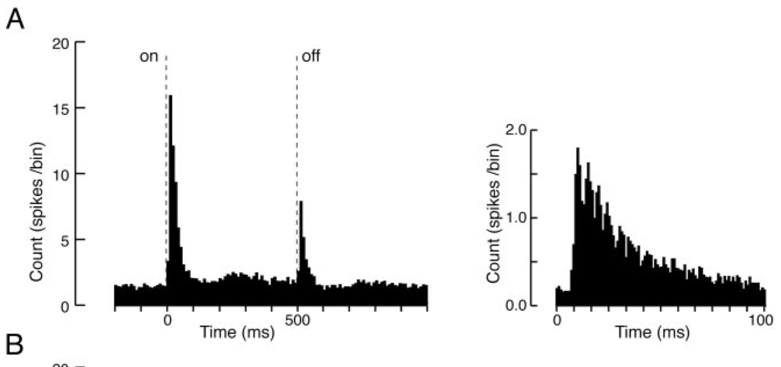
Contact onset and release evoke distinct responses
Sachdev and Catania measured cortical firing during 500-ms indentations. An ON response is evoked at contact onset, and an OFF response follows release. Both events change mechanical strain even though their effects on the skin have opposite directions. Each event is a transition, so the same stimulus produces two responses. Both responses are timed relative to the stimulus transition.
About 61% of recorded neurons had an excitatory OFF response. Its mean latency was 12.2 ms and mean duration 39.1 ms, comparable to the brief ON discharge, and many units showed suppression after onset rather than maintaining an elevated rate throughout the hold. The OFF response is a common feature of the recorded population.
The timing supports a code sensitive to transitions as well as continuing contact. Extracellular firing records establish the response dynamics, and the synaptic and intrinsic mechanisms form a separate matter. A transition code gives the cortex information about both the start and the end of contact. The response code therefore carries timing information.
Sachdev & Catania (2002), Fig. 8(A). Population onset and release responses to 500-ms contact.
Sachdev & Catania (2002); Gerhold et al. (2013)
40
Notes:
• Sachdev and Catania measured cortical firing during 500-ms indentations. An ON response is evoked at contact onset; an OFF response follows its release. The two events can both change mechanical strain even though their effects on the skin have opposite directions.
– A neuron’s response to release can carry information about contact ending. The experiment measured mechanical release directly; it did not ask the animal to report whether an object had departed.
• About 61% of recorded neurons had an excitatory OFF response. Its mean latency was 12.2 ms and mean duration 39.1 ms, comparable to the brief ON discharge. Many units showed suppression after onset instead of maintaining an elevated rate throughout the hold.
• The timing supports a code sensitive to transitions as well as continuing contact. It does not mean the OFF response signals prey rejection or that inhibition requires a specific transmitter identified here. Extracellular firing records establish response dynamics while leaving synaptic and intrinsic mechanisms partly unresolved.
References:
Sachdev RNS, Catania KC (2002). Receptive Fields and Response Properties of Neurons in the Star-Nosed Mole's Somatosensory Fovea. Journal of Neurophysiology 87(5):2602-2611. https://doi.org/10.1152/jn.2002.87.5.2602
Gerhold KA, Pellegrino M, Tsunozaki M, Morita T, Leitch DB, Tsuruda PR, Brem RB, Catania KC, Bautista DM (2013). The Star-Nosed Mole Reveals Clues to the Molecular Basis of Mammalian Touch. PLoS ONE 8(1):e55001. https://doi.org/10.1371/journal.pone.0055001
Figure: Sachdev & Catania (2002), Fig. 8(A). Population onset and release responses to 500-ms contact.
Figure source: https://doi.org/10.1152/jn.2002.87.5.2602

Slide 54
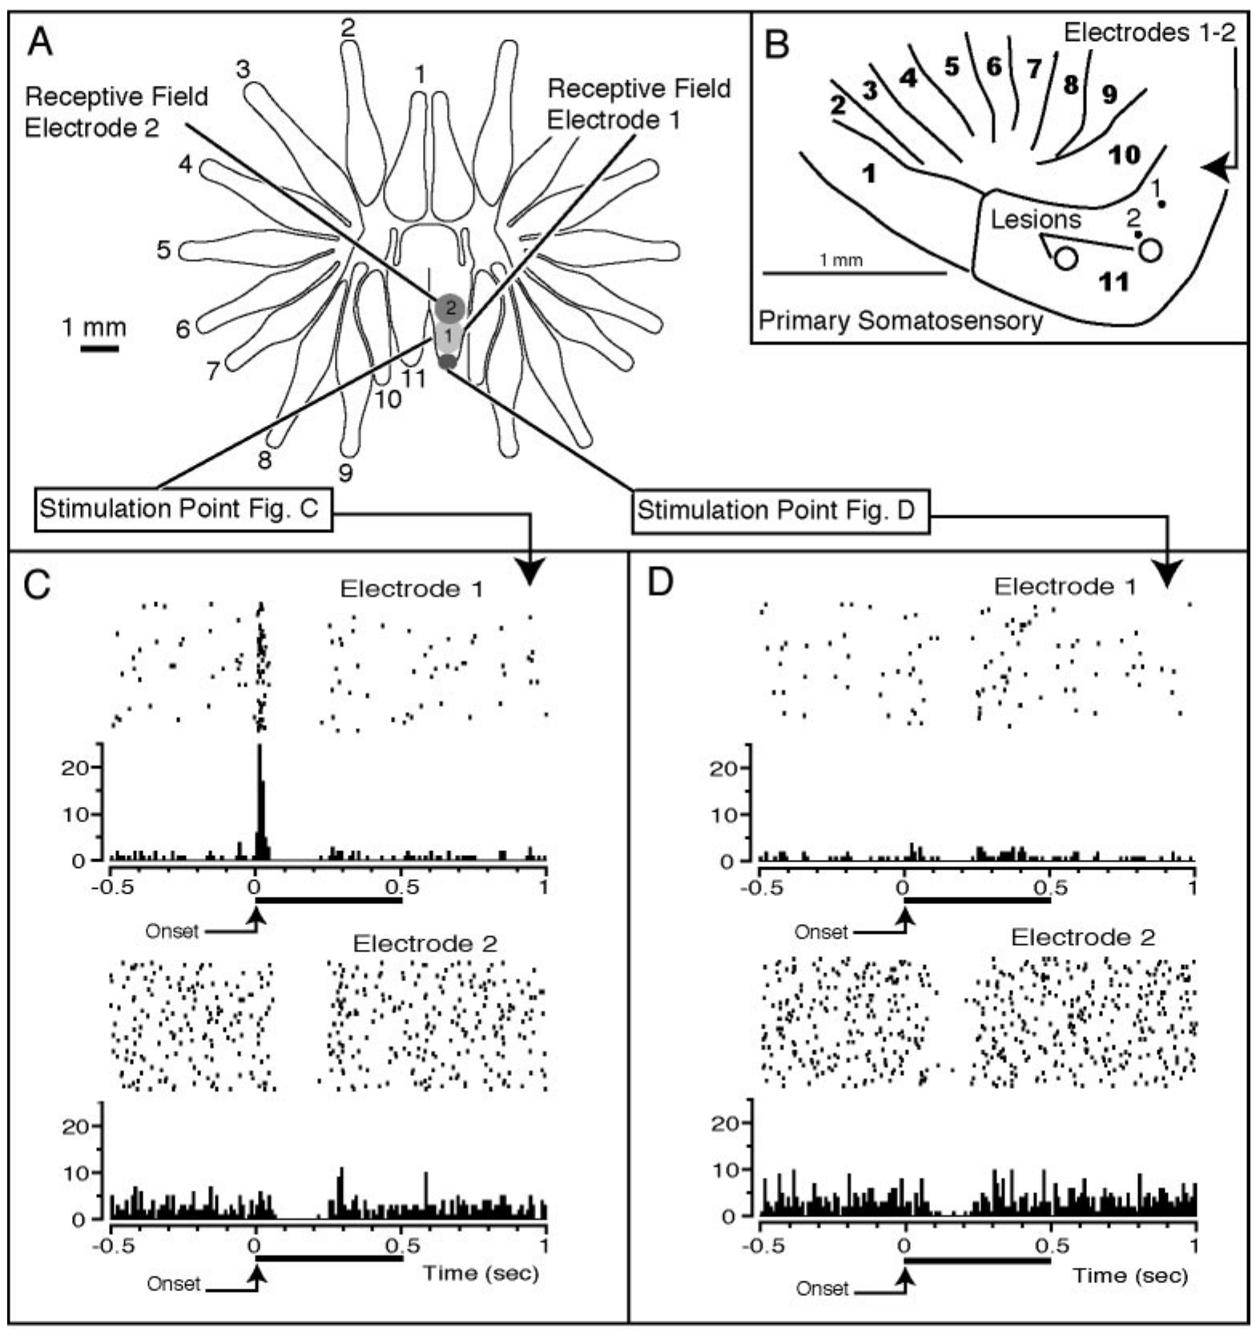
Surround stimulation can suppress a cortical neuron
Sachdev and Catania used simultaneous recordings at electrodes 200 µm apart while moving the probe among mapped sites. Center–surround organization means that stimulation in a central receptive region can excite a neuron, while stimulation outside that region reduces its activity. Two electrodes make the surround visible in the same moment across both sites.
In paired examples, one contact excited a neuron whose field included that position and suppressed another whose field lay elsewhere. Suppression was measured relative to spontaneous firing, which distinguishes an inhibitory influence from simply failing to excite a neuron. Spontaneous firing gives the reference against which suppression is seen. Each example involves one excited and one suppressed neuron.
The findings support interactions that sharpen the spatial pattern of cortical activity. Firing suppression alone leaves the transmitter-specific mechanism open. The interaction is a spatial effect within the mapped field. Center–surround organization therefore operates within a single cortical map. The organization is a spatial code, not a transmitter code. The spatial pattern is a cortical property.
Catania & Kaas (1997), Fig. 10(B–C). Cytochrome-oxidase stripes of S1 and S2 in flattened cortex.
Sachdev & Catania (2002), Fig. 6(A–F). Simultaneous recordings of excitation and suppression.
Sachdev & Catania (2002); Catania & Kaas (1997)
41
Notes:
• Sachdev and Catania used simultaneous recordings at electrodes separated by 200 µm while moving the probe among mapped sites. Center–surround organization means that stimulation in a central receptive region can excite a neuron while stimulation outside that region reduces its activity.
– Extracellular suppression describes a reduction in spikes. Synaptic inhibition is one possible mechanism, but reduced excitation or other network effects can also lower a neuron’s firing rate.
• In paired examples, one contact excited a neuron whose field included that position and suppressed another whose field lay elsewhere. Suppression was measured relative to spontaneous firing. This separates an inhibitory influence from merely failing to excite a neuron at an unrelated location.
• The findings support interactions that sharpen the spatial pattern of cortical activity. They do not identify whether suppression originates within cortex, in earlier relays or through a particular inhibitory synapse. No pharmacological blockade in this study established GABA receptor involvement, so transmitter-specific mechanisms should not be assigned from firing suppression alone.
References:
Sachdev RNS, Catania KC (2002). Receptive Fields and Response Properties of Neurons in the Star-Nosed Mole's Somatosensory Fovea. Journal of Neurophysiology 87(5):2602-2611. https://doi.org/10.1152/jn.2002.87.5.2602
Catania KC, Kaas JH (1997). Somatosensory fovea in the star-nosed mole: Behavioral use of the star in relation to innervation patterns and cortical representation. The Journal of Comparative Neurology 387(2):215-233. https://doi.org/10.1002/(sici)1096-9861(19971020)387:2<215::aid-cne4>3.0.co;2-3
Figure: Sachdev & Catania (2002), Fig. 6(A–F). Simultaneous recordings of excitation and suppression.
Figure source: https://doi.org/10.1152/jn.2002.87.5.2602
Figure: Catania & Kaas (1997), Fig. 10(B–C). Cytochrome-oxidase stripes of S1 and S2 in flattened cortex.
Figure source: https://doi.org/10.1002/(sici)1096-9861(19971020)387:2<215::aid-cne4>3.0.co;2-3

Slide 55
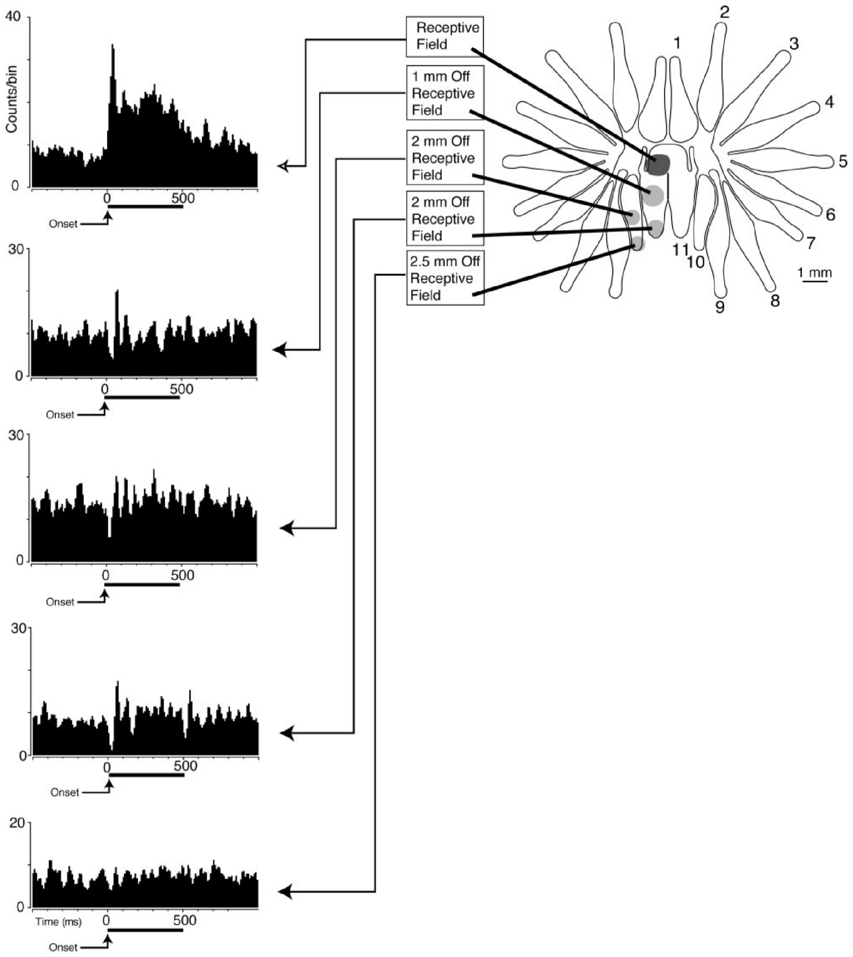
Moving contact changes excitation into suppression
Sachdev and Catania moved a controlled mechanical stimulus progressively away from a mapped field center. This tests whether a response boundary is an absence of excitation or an active suppression. Moving the stimulus step by step traces the boundary from the inside outward. The approach reveals the shape of the boundary. Each step is defined by a measured position.
In the illustrated neuron, central contact elicited a strong discharge, and a more distal position on ray 11 suppressed firing for approximately 40 ms. The contact pattern across the field therefore changes from excitation to suppression as it moves outward. Its center and surround therefore both belong to one neuron. A single neuron can carry both effects.
The positional dependence supports a spatially structured response rather than uniform sensitivity across the appendage. Whether these interactions sharpen awake prey discrimination is a question the anesthetized preparation leaves open. The anesthetized preparation therefore leaves the awake contact dynamics for later study. Spatial structure is measured in each field separately. Each field's shape can be defined separately.
Gerhold et al. (2013), Fig. 1(C–D). Original organ anatomy and NF200/substance-P labeling.
Sachdev & Catania (2002), Fig. 7. Responses as contact moves from the receptive-field center.
Sachdev & Catania (2002); Gerhold et al. (2013)
42
Notes:
• Sachdev and Catania moved a controlled mechanical stimulus progressively away from a mapped field center. This tests whether a response boundary is only an absence of excitation or includes active suppression. Baseline spontaneous activity provided the reference for detecting decreases.
– A receptive-field border is measured from responses, not inferred from the physical outline of the ray. Several response zones can therefore occupy one appendage.
• In the illustrated neuron, central contact elicited a strong discharge. A more distal position on ray 11 suppressed firing for approximately 40 ms, and other positions produced different response magnitudes. Most inhibitory surrounds were larger than the central excitatory patch, yet remained largely confined to one ray.
• The positional dependence supports a spatially structured response rather than a uniform sensitivity across the appendage. The single example does not establish the same suppression duration for every neuron. It also leaves unresolved whether these interactions improve awake prey discrimination or depend on the tested contact mechanics.
References:
Sachdev RNS, Catania KC (2002). Receptive Fields and Response Properties of Neurons in the Star-Nosed Mole's Somatosensory Fovea. Journal of Neurophysiology 87(5):2602-2611. https://doi.org/10.1152/jn.2002.87.5.2602
Gerhold KA, Pellegrino M, Tsunozaki M, Morita T, Leitch DB, Tsuruda PR, Brem RB, Catania KC, Bautista DM (2013). The Star-Nosed Mole Reveals Clues to the Molecular Basis of Mammalian Touch. PLoS ONE 8(1):e55001. https://doi.org/10.1371/journal.pone.0055001
Figure: Sachdev & Catania (2002), Fig. 7. Responses as contact moves from the receptive-field center.
Figure source: https://doi.org/10.1152/jn.2002.87.5.2602
Figure: Gerhold et al. (2013), Fig. 1(C–D). Original organ anatomy and NF200/substance-P labeling.
Figure source: https://doi.org/10.1371/journal.pone.0055001

Slide 56
Suppression borders follow response fields
A response boundary may be an absence of excitation, or it may include active suppression, and this experiment tested which. The stimulus was moved progressively from the field center, and decreases were scored relative to the neuron's spontaneous firing.
Most inhibitory surrounds were larger than the central excitatory patch, and they remained largely confined to one ray. A distal spot on ray 11 reduced firing for roughly 40 ms in the illustrated neuron, after central contact had driven a strong discharge.
Other positions on the same neuron produced different response magnitudes, so the response changes gradually as contact moves outward from the center. Most fields were continuous patches within one ray. The excitatory and suppressive parts of the response occupy neighboring positions on the same ray.
Gerhold et al. (2013), Fig. 1(C–D). Original organ anatomy and NF200/substance-P labeling.
Sachdev & Catania (2002), Fig. 7. Responses as contact moves from the receptive-field center.
Sachdev & Catania (2002)
42a
Notes:
• Suppression borders follow response fields.
• Explanation 1.
– A response boundary may be an absence of excitation, or it may include active suppression, and this experiment tested which
– The stimulus was moved progressively from the field center, and decreases were scored relative to the neuron's spontaneous firing.
• Explanation 2.
– Most inhibitory surrounds were larger than the central excitatory patch, and they remained largely confined to one ray
– A distal spot on ray 11 reduced firing for roughly 40 ms in the illustrated neuron, after central contact had driven a strong discharge.
• Explanation 3.
– Other positions on the same neuron produced different response magnitudes, so the response changes gradually as contact moves outward from the center
– Most fields were continuous patches within one ray. The excitatory and suppressive parts of the response occupy neighboring positions on the same ray.
• Source.
– The figure and the measurements come from Sachdev & Catania (2002).
– Each statement is tied to the recordings or observations of that study.
References:
Sachdev RNS, Catania KC (2002). Receptive Fields and Response Properties of Neurons in the Star-Nosed Mole's Somatosensory Fovea. Journal of Neurophysiology 87(5):2602-2611. https://doi.org/10.1152/jn.2002.87.5.2602

Slide 57
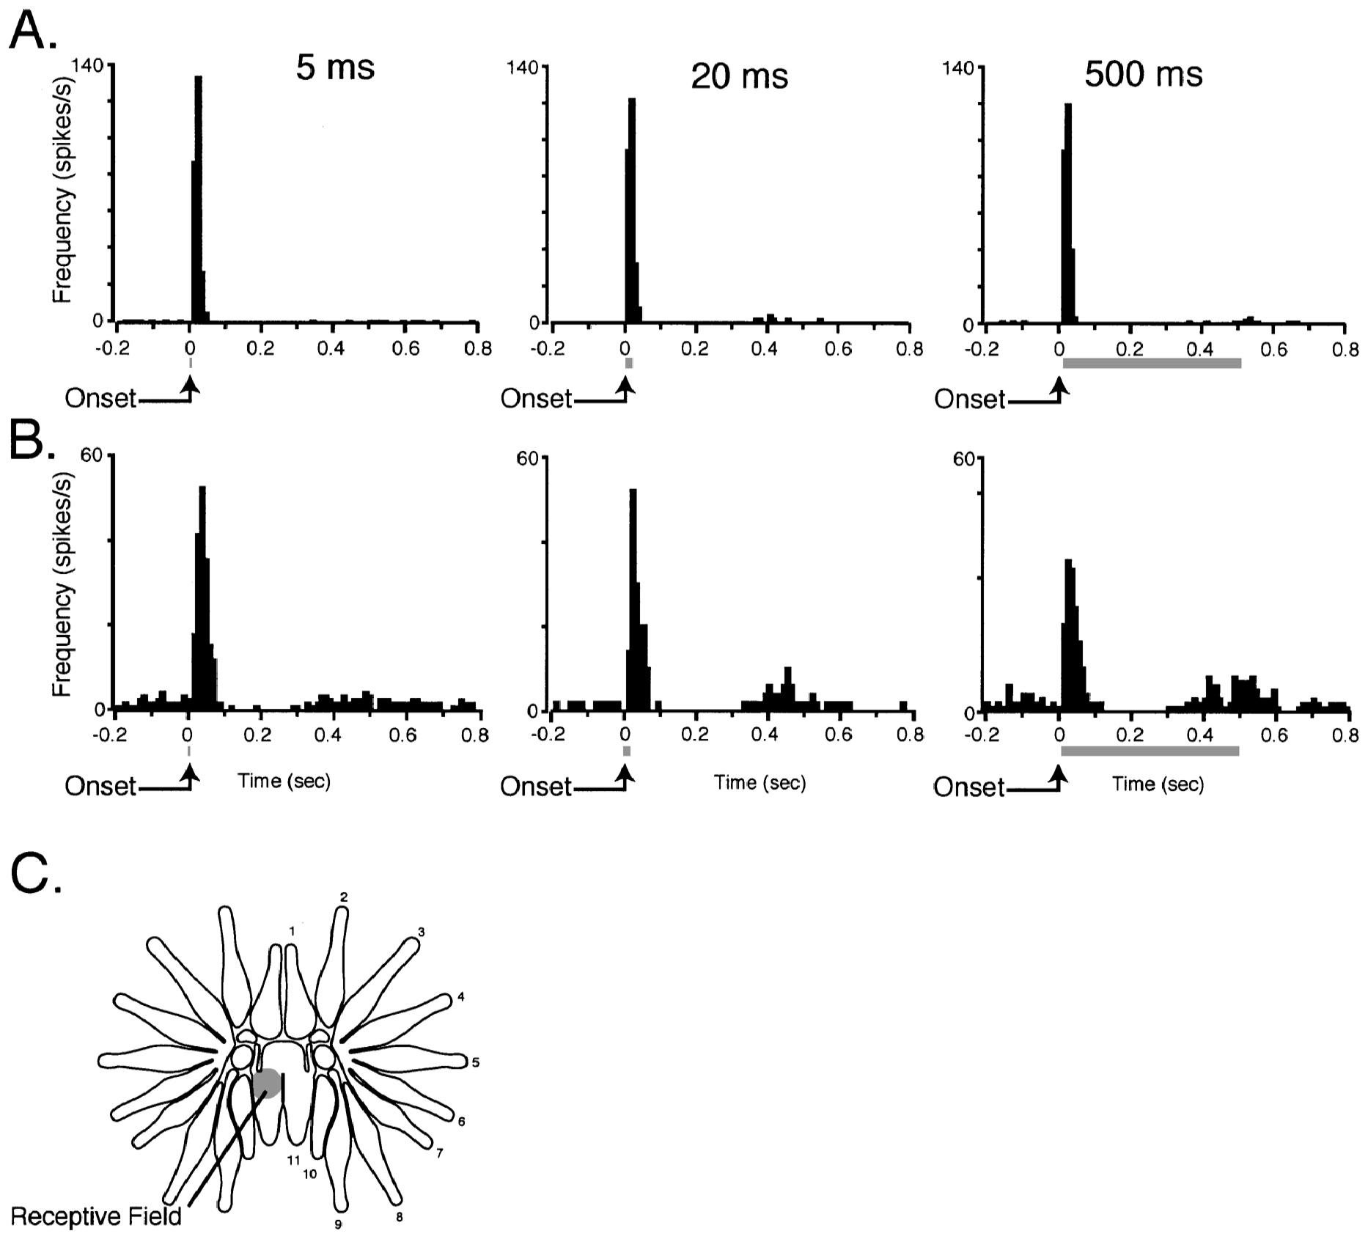
Contact duration recruits transient and sustained codes
Sachdev and Catania compared cortical responses to 5-, 20- and 500-ms stimuli delivered to the same receptive fields. Transient responses emphasize short changes near onset, whereas sustained responses continue during contact. The same fields respond differently depending on how long the stimulus lasts. Each class is defined by its firing across the stimulus.
The 5- and 20-ms stimuli mainly produced brief responses. The 500-ms stimulus separated neurons whose activity persisted from neurons with an initial discharge followed by suppression, and some sustained units varied in their timing. The long stimulus reveals more classes of response than short stimuli do. Transient and sustained neurons are distinguished by their response pattern.
Multiple temporal representations of contact duration exist within cortex. A short natural touch can activate these neurons, though a brief contact produces a different pattern from a long hold. Duration is therefore encoded by more than one response type. Such duration coding is measured from the same receptive fields. The same fields carry both signal types.
Catania & Kaas (1997), Fig. 10(B–C). Cytochrome-oxidase stripes of S1 and S2 in flattened cortex.
Sachdev & Catania (2002), Fig. 2(A–C). Different transient and sustained responses across stimulus durations.
Sachdev & Catania (2002); Catania & Kaas (1997)
43
Notes:
• Sachdev and Catania compared cortical responses to 5-, 20- and 500-ms stimuli delivered to the same receptive fields. Transient responses emphasize short changes near onset, whereas sustained responses continue during contact. These categories concern recorded activity rather than an assumed receptor identity.
– Applying different durations to the same mapped site limits a spatial confound. The neuronal class is defined by the prolonged-stimulus response, not by an anatomical identification of its peripheral input.
• The 5- and 20-ms stimuli mainly produced brief responses. The 500-ms stimulus separated neurons whose activity persisted from neurons with an initial discharge followed by suppression. Some sustained units also varied in their timing rather than responding as a perfectly constant firing-rate signal.
• The comparison supports multiple temporal representations of contact duration within cortex. A short natural touch can activate these neurons without reproducing their response to a long hold. The data do not prove that transient and sustained cortical units correspond one-to-one to the peripheral rapidly and slowly adapting receptor classes.
References:
Sachdev RNS, Catania KC (2002). Effects of stimulus duration on neuronal response properties in the somatosensory cortex of the star-nosed mole. Somatosensory & Motor Research 19(4):272-278. https://doi.org/10.1080/0899022021000037737
Catania KC, Kaas JH (1997). Somatosensory fovea in the star-nosed mole: Behavioral use of the star in relation to innervation patterns and cortical representation. The Journal of Comparative Neurology 387(2):215-233. https://doi.org/10.1002/(sici)1096-9861(19971020)387:2<215::aid-cne4>3.0.co;2-3
Figure: Sachdev & Catania (2002), Fig. 2(A–C). Different transient and sustained responses across stimulus durations.
Figure source: https://doi.org/10.1080/0899022021000037737
Figure: Catania & Kaas (1997), Fig. 10(B–C). Cytochrome-oxidase stripes of S1 and S2 in flattened cortex.
Figure source: https://doi.org/10.1002/(sici)1096-9861(19971020)387:2<215::aid-cne4>3.0.co;2-3

Slide 58
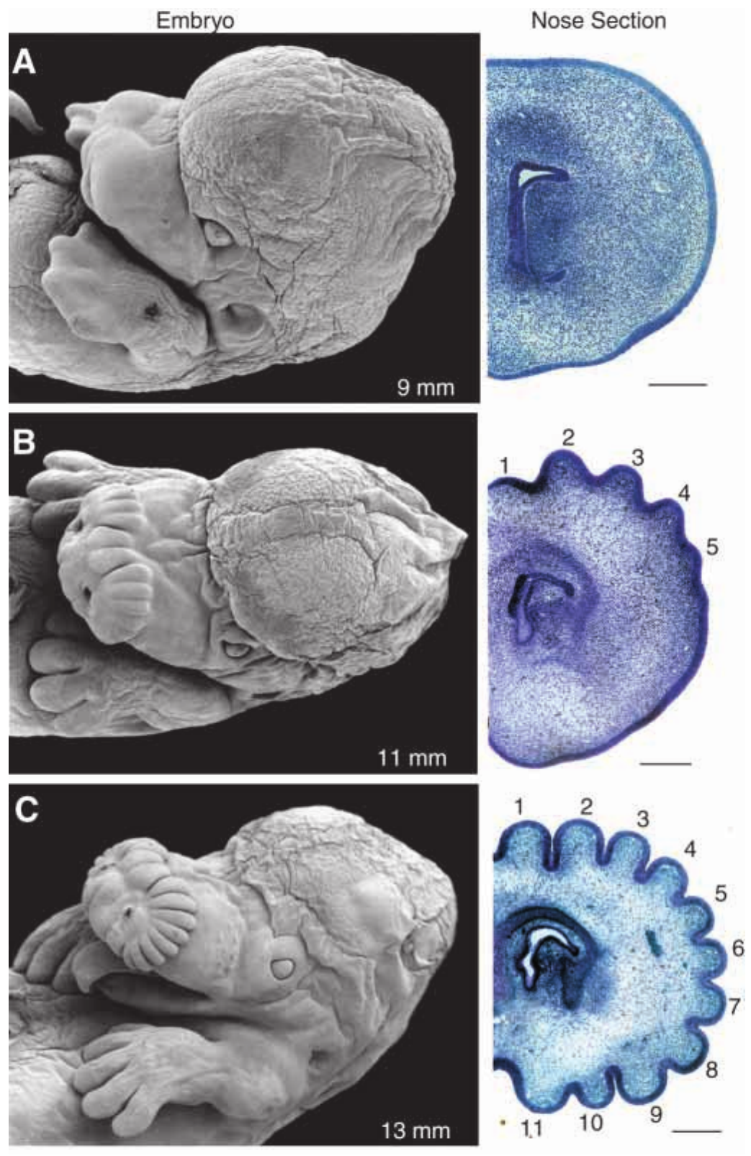
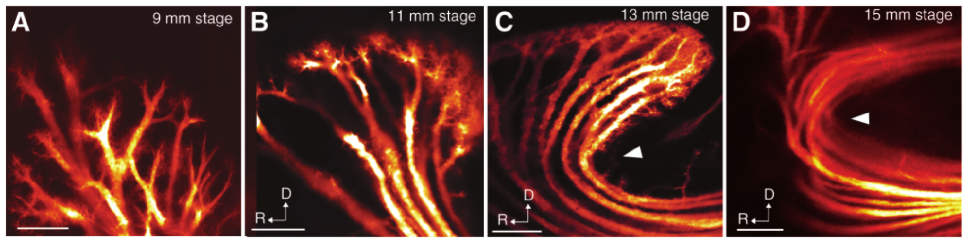
The star forms within the embryonic facial epidermis
Catania, Northcutt and Kaas examined embryos with scanning microscopy and stained sections. Morphogenesis is the formation of an anatomical structure during development, and the mole's rays formed as patterned epidermal waves before becoming free appendages. The rays were shaped within the facial skin before they projected outward. The rays first appear as epidermal structures.
At a 9-mm embryonic stage, the nose lacked differentiated rays. At 11 mm, a series of epidermal crests appeared, and by 13–15 mm the 22-ray pattern was apparent. The three stages mark the sequence in which the star takes shape. Each stage is defined by the crest pattern visible at that length.
This developmental sequence establishes how the star's basic structure emerges. Embryo length is a staging measure, so the sequence is ordered by developmental stage rather than by elapsed time in days. The stages are a way of ordering the observed shapes in time. The ordering is developmental rather than chronological. Embryo length serves as the stage marker.
Catania et al. (1999), Fig. 2(A–D). DiI-labeled innervation during ray formation.
Catania et al. (1999), Fig. 1(A–C). Prenatal ray formation and corresponding stained nose sections.
Catania et al. (1999)
44
Notes:
• Catania, Northcutt and Kaas examined embryos with scanning microscopy and stained sections. Morphogenesis is the formation of an anatomical structure during development. The mole’s rays formed as patterned epidermal waves before becoming free appendages, rather than initially projecting outward as separate limbs.
– A crest is a raised part of the developing epidermis. The later ray derives from reorganized facial tissue, so adult appearance alone would not reveal this developmental route.
• At a 9-mm embryonic stage, the nose lacked differentiated rays. At 11 mm, a series of epidermal crests appeared; by 13–15 mm, the 22-ray pattern was apparent. The original sections locate developing nerves relative to the tissue layers that later separate.
• This developmental sequence establishes how the star’s basic structure emerges. Embryo length is a staging measure, not elapsed time in days. The observations do not identify a gene controlling the pattern or demonstrate that the sequence recapitulates the evolutionary history of the star.
References:
Catania KC, Northcutt RG, Kaas JH (1999). The development of a biological novelty: a different way to make appendages as revealed in the snout of the star-nosed mole Condylura cristata. Journal of Experimental Biology 202(20):2719-2726. https://doi.org/10.1242/jeb.202.20.2719
Figure: Catania et al. (1999), Fig. 1(A–C). Prenatal ray formation and corresponding stained nose sections.
Figure source: https://doi.org/10.1242/jeb.202.20.2719
Figure: Catania et al. (1999), Fig. 2(A–D). DiI-labeled innervation during ray formation.
Figure source: https://doi.org/10.1242/jeb.202.20.2719

Slide 59
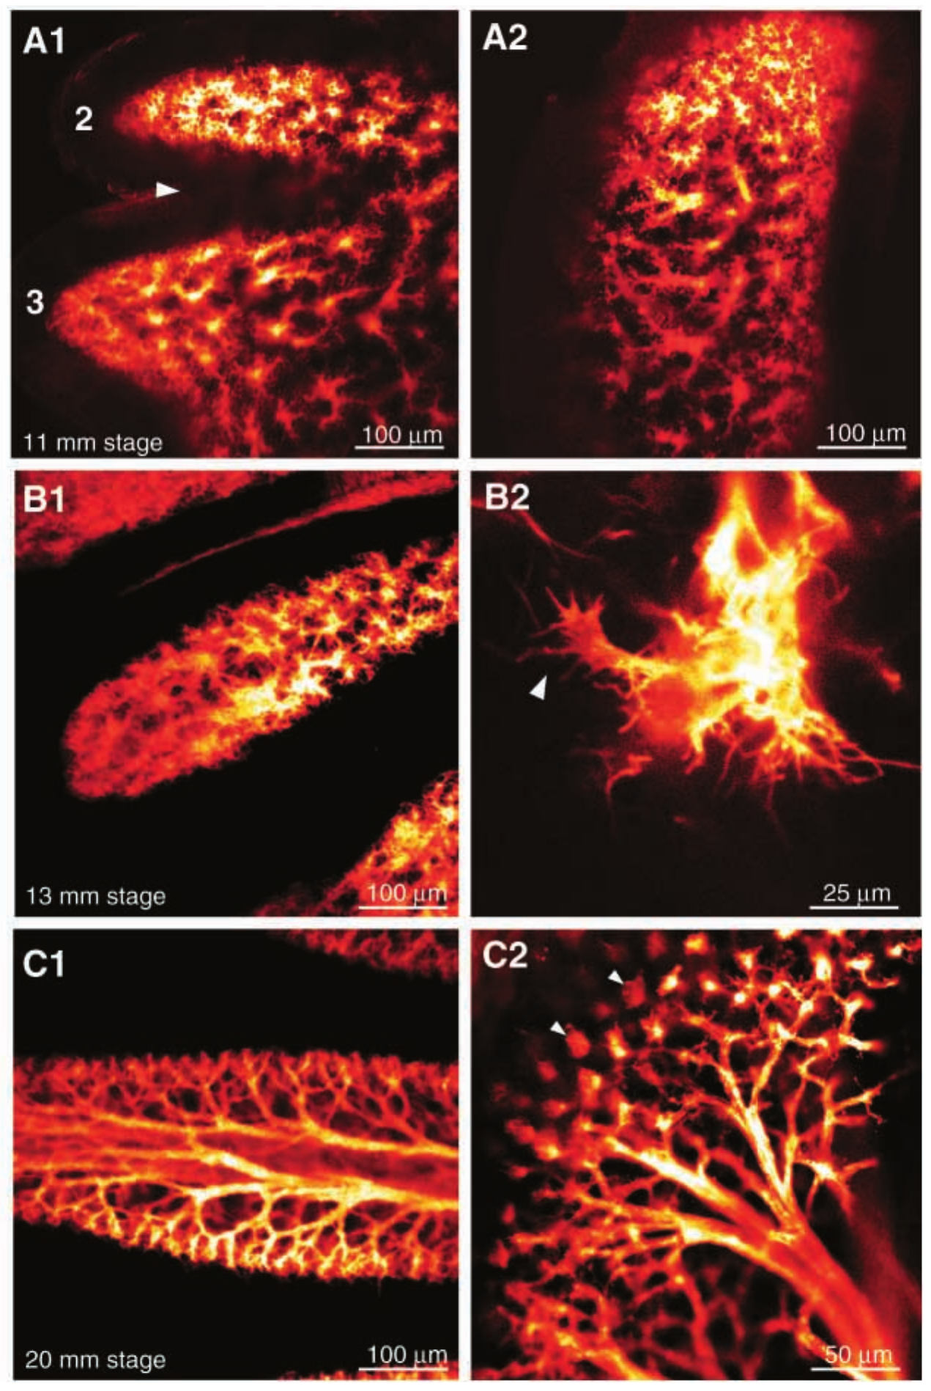
Ray-specific innervation develops before free movement
Catania and colleagues traced embryonic facial nerves with DiI while the star's rays were still embedded in the facial epidermis. This preparation relates nerve organization to tissue morphogenesis before the newborn has the freely moving adult sensory surface. The nerves are traced while the tissue is still forming. The DiI labeling records where each nerve runs.
An initially broad nerve network became organized into fascicles supplying epidermal crests. Subsequent tissue growth displaced the nerves around a deeper epidermal layer, and by later embryonic stages terminal arrangements approached the rings characteristic of adult Eimer's organs. The nerve pattern changes shape as the tissue grows around it. The nerve arrangement changes with each growth stage.
The sequence supports coordinated development of the receptor surface and its innervation. Rays emerge approximately one week after birth, which places free movement well after the nerve pattern forms. The nerve pattern is therefore in place before the ray can move freely. The receptor surface and its nerves therefore develop together. The early nerve pattern precedes the free appendage.
Catania et al. (1999), Fig. 2(A–D). DiI-labeled innervation during ray formation.
Catania et al. (1999), Fig. 3(A1–C2). Development of ray-specific nerves and terminal rings.
Catania et al. (1999)
45
Notes:
• Catania and colleagues traced embryonic facial nerves with DiI while the star’s rays were still embedded in the facial epidermis. The preparation relates nerve organization to tissue morphogenesis before the newborn possesses the freely moving adult sensory surface.
– A fascicle is a bundle of axons traveling together. The tracing records an evolving anatomical pathway, not neuronal firing during embryonic touch.
• An initially broad nerve network became organized into fascicles supplying epidermal crests. Subsequent tissue growth displaced the nerves around a deeper epidermal layer. By later embryonic stages, terminal arrangements approached the rings characteristic of adult Eimer’s organs; rays emerged approximately one week after birth.
• The sequence supports coordinated development of the receptor surface and its innervation. It does not establish which molecular signal directs axons or whether early experience determines adult cortical magnification. Anatomical specialization preceding free ray movement also cautions against explaining the entire system solely through repeated adult foveation.
References:
Catania KC, Northcutt RG, Kaas JH (1999). The development of a biological novelty: a different way to make appendages as revealed in the snout of the star-nosed mole Condylura cristata. Journal of Experimental Biology 202(20):2719-2726. https://doi.org/10.1242/jeb.202.20.2719
Figure: Catania et al. (1999), Fig. 2(A–D). DiI-labeled innervation during ray formation.
Figure source: https://doi.org/10.1242/jeb.202.20.2719
Figure: Catania et al. (1999), Fig. 3(A1–C2). Development of ray-specific nerves and terminal rings.
Figure source: https://doi.org/10.1242/jeb.202.20.2719

Slide 60
Key takeaways
Active touch uses a fovea Broad initial contact is followed by repositioning of ray 11; the star senses and positions prey while incisors grasp it.
Fast handling changes prey value Small-prey handling averages 227 ms; low handling costs make tiny prey profitable, while search costs still depend on encounter rate.
Peripheral specialization has several levels Eimer’s organs contain multiple endings; foveal specialization involves afferent investment and cannot be explained solely by dome density.
Molecular evidence has limits TG neurons are enriched for mechanosensitivity; transcript and protein enrichment identify candidate channels without proving their causal role.
Central allocation magnifies ray 11 Ray 11 accounts for about 11% of afferents, 14% of the PrV star representation and 25% of the S1 star representation.
Spatial and temporal codes complement each other Small foveal fields, center–surround suppression and distinct onset, release and sustained responses encode different aspects of contact.
Catania & Kaas (1997); Catania & Remple (2005); Gerhold et al. (2013); Catania et al. (2011); Sachdev & Catania (2002)
46
Notes:
• Active touch uses a fovea. Broad initial contact is followed by repositioning of ray 11; the star senses and positions prey while incisors grasp it.
• Fast handling changes prey value. Small-prey handling averages 227 ms; low handling costs make tiny prey profitable, while search costs still depend on encounter rate.
• Peripheral specialization has several levels. Eimer’s organs contain multiple endings; foveal specialization involves afferent investment and cannot be explained solely by dome density.
• Molecular evidence has limits. TG neurons are enriched for mechanosensitivity; transcript and protein enrichment identify candidate channels without proving their causal role.
• Central allocation magnifies ray 11. Ray 11 accounts for about 11% of afferents, 14% of the PrV star representation and 25% of the S1 star representation.
• Spatial and temporal codes complement each other. Small foveal fields, center–surround suppression and distinct onset, release and sustained responses encode different aspects of contact.
References:
Catania KC, Kaas JH (1997). Somatosensory fovea in the star-nosed mole: Behavioral use of the star in relation to innervation patterns and cortical representation. The Journal of Comparative Neurology 387(2):215-233. https://doi.org/10.1002/(sici)1096-9861(19971020)387:2<215::aid-cne4>3.0.co;2-3
Catania KC, Remple FE (2005). Asymptotic prey profitability drives star-nosed moles to the foraging speed limit. Nature 433(7025):519-522. https://doi.org/10.1038/nature03250
Marasco PD, Catania KC (2007). Response properties of primary afferents supplying Eimer's organ. Journal of Experimental Biology 210(5):765-780. https://doi.org/10.1242/jeb.02690
Marasco PD, Tsuruda PR, Bautista DM, Julius D, Catania KC (2006). Neuroanatomical evidence for segregation of nerve fibers conveying light touch and pain sensation in Eimer’s organ of the mole. Proceedings of the National Academy of Sciences 103(24):9339-9344. https://doi.org/10.1073/pnas.0603229103
Gerhold KA, Pellegrino M, Tsunozaki M, Morita T, Leitch DB, Tsuruda PR, Brem RB, Catania KC, Bautista DM (2013). The Star-Nosed Mole Reveals Clues to the Molecular Basis of Mammalian Touch. PLoS ONE 8(1):e55001. https://doi.org/10.1371/journal.pone.0055001
Catania KC, Leitch DB, Gauthier D (2011). A Star in the Brainstem Reveals the First Step of Cortical Magnification. PLoS ONE 6(7):e22406. https://doi.org/10.1371/journal.pone.0022406
Sachdev RNS, Catania KC (2002). Receptive Fields and Response Properties of Neurons in the Star-Nosed Mole's Somatosensory Fovea. Journal of Neurophysiology 87(5):2602-2611. https://doi.org/10.1152/jn.2002.87.5.2602
Sachdev RNS, Catania KC (2002). Effects of stimulus duration on neuronal response properties in the somatosensory cortex of the star-nosed mole. Somatosensory & Motor Research 19(4):272-278. https://doi.org/10.1080/0899022021000037737
Sawyer EK, Catania KC (2016). Somatosensory organ topography across the star of the star‐nosed mole (Condylura cristata). Journal of Comparative Neurology 524(5):917-929. https://doi.org/10.1002/cne.23943
Catania KC, Northcutt RG, Kaas JH (1999). The development of a biological novelty: a different way to make appendages as revealed in the snout of the star-nosed mole Condylura cristata. Journal of Experimental Biology 202(20):2719-2726. https://doi.org/10.1242/jeb.202.20.2719

