Slide 1
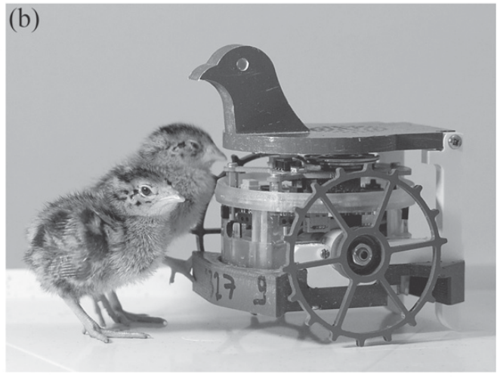
NEUR 411 · NEUROETHOLOGY · FALL 2026
Lecture 77
Substitute parents:
decoys, robots, imprinting, surrogate caregivers, and cross-fostering across species
Date TBD
Jordan Lopez, Ph.D.
Professor of Neurobiology & Biomedical Engineering
Jolly et al. (2016), Fig. 1b. Japanese quail chicks and the mobile bird-head decoy.
Notes:
Substitute parents: decoys, robots, imprinting, surrogate caregivers, and cross-fostering across species
Lecture 77. NEUR 411 · NEUROETHOLOGY · FALL 2026. Date TBD.
Figure: Jolly et al. (2016), Fig. 1b. Japanese quail chicks and the mobile bird-head decoy.
Figure source: https://doi.org/10.1088/1748-3190/11/1/016007
References:
L Jolly, F Pittet, J-P Caudal, J-B Mouret, C Houdelier, S Lumineau, E de Margerie (2016). Animal-to-robot social attachment: initial requisites in a gallinaceous bird. Bioinspiration & Biomimetics 11(1):016007. https://doi.org/10.1088/1748-3190/11/1/016007

Slide 2
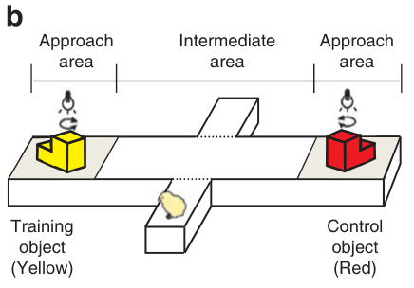
Moving objects acquire a filial preference
Filial imprinting is the learning through which a newly hatched bird develops a preference for a familiar social target. Domestic chicks can acquire this preference for an artificial moving object, even though the object supplies neither milk nor parental care.
Yamaguchi and colleagues trained chicks with moving yellow LEGO blocks. A later choice test presented the familiar yellow object and a novel red object. Greater approach to the familiar target measured the learned visual preference independently of the original training encounter.
The target’s movement recruits following behavior, while its visible features distinguish it from alternatives. Early experience therefore gives an otherwise arbitrary object a selective behavioral role: chicks approach that particular object rather than every available moving stimulus.
Yamaguchi et al. (2012), Fig. 2b. Moving LEGO stimuli and the preference-test apparatus.
Yamaguchi et al. (2012)
02
Notes:
• Filial imprinting is the learning through which a newly hatched bird develops a preference for a familiar social target. Domestic chicks can acquire this preference for an artificial moving object, even though the object supplies neither milk nor parental care.
• Yamaguchi and colleagues trained chicks with moving yellow LEGO blocks. A later choice test presented the familiar yellow object and a novel red object. Greater approach to the familiar target measured the learned visual preference independently of the original training encounter.
• The target’s movement recruits following behavior, while its visible features distinguish it from alternatives. Early experience therefore gives an otherwise arbitrary object a selective behavioral role: chicks approach that particular object rather than every available moving stimulus.
References:
Shinji Yamaguchi, Naoya Aoki, Takaaki Kitajima, Eiji Iikubo, Sachiko Katagiri, Toshiya Matsushima, Koichi J. Homma (2012). Thyroid hormone determines the start of the sensitive period of imprinting and primes later learning. Nature Communications 3(1):1081. https://doi.org/10.1038/ncomms2088
Figure: Yamaguchi et al. (2012), Fig. 2b. Moving LEGO stimuli and the preference-test apparatus.
Figure source: https://doi.org/10.1038/ncomms2088

Slide 3
Artificial targets isolate imprinting cues
An artificial caregiver allows the visual identity of an attachment target to be changed while its movement remains controlled. In the chick experiments, yellow and red LEGO objects provided distinguishable visual stimuli rather than two living adults with different calls or behavior.
Training and preference testing were separate procedures. Chicks encountered the training object for 1 hour and subsequently chose between familiar and unfamiliar targets. A preference required discrimination between the objects, whereas activity during training measured approach to a moving stimulus.
The two measurements separate participation in the encounter from what is learned about the target. Following creates repeated exposure to visual features, and the later choice expresses a memory of those features. Artificial targets thus isolate a sensory component of filial attachment.
Yamaguchi et al. (2012), Fig. 2b. Moving LEGO stimuli and the preference-test apparatus.
Yamaguchi et al. (2012)
03
Notes:
• An artificial caregiver allows the visual identity of an attachment target to be changed while its movement remains controlled. In the chick experiments, yellow and red LEGO objects provided distinguishable visual stimuli rather than two living adults with different calls or behavior.
• Training and preference testing were separate procedures. Chicks encountered the training object for 1 hour and subsequently chose between familiar and unfamiliar targets. A preference required discrimination between the objects, whereas activity during training measured approach to a moving stimulus.
• The two measurements separate participation in the encounter from what is learned about the target. Following creates repeated exposure to visual features, and the later choice expresses a memory of those features. Artificial targets thus isolate a sensory component of filial attachment.
References:
Shinji Yamaguchi, Naoya Aoki, Takaaki Kitajima, Eiji Iikubo, Sachiko Katagiri, Toshiya Matsushima, Koichi J. Homma (2012). Thyroid hormone determines the start of the sensitive period of imprinting and primes later learning. Nature Communications 3(1):1081. https://doi.org/10.1038/ncomms2088
Figure: Yamaguchi et al. (2012), Fig. 2b. Moving LEGO stimuli and the preference-test apparatus.
Figure source: https://doi.org/10.1038/ncomms2088

Slide 4
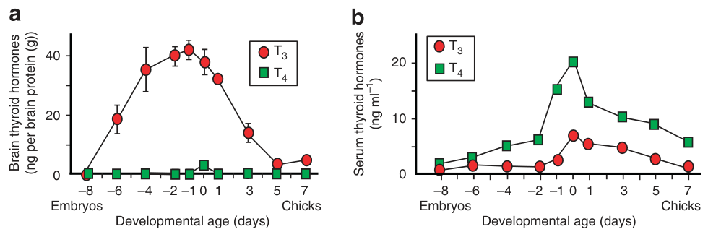
Sensitive periods constrain early attachment
A sensitive period is a developmental interval during which a particular experience readily changes later behavior. Newly hatched chicks learn a filial preference during their first few days, whereas older untrained chicks ordinarily acquire little preference under the same training conditions.
Brain thyroid hormones change around hatching. Thyroxine, or T4, is a circulating precursor; triiodothyronine, or T3, is its more active product. Brain T3 declines over the first several days, linking the timing of early learning to a changing hormonal environment.
This developmental change concerns responsiveness to experience rather than the visual identity of the caregiver. The familiar object still supplies the information that is learned. Hormonal state changes whether exposure to that information can establish a new filial preference.
Yamaguchi et al. (2012), Fig. 3a–b. Brain and serum thyroid hormones change around hatching.
Yamaguchi et al. (2012)
04
Notes:
• A sensitive period is a developmental interval during which a particular experience readily changes later behavior. Newly hatched chicks learn a filial preference during their first few days, whereas older untrained chicks ordinarily acquire little preference under the same training conditions.
• Brain thyroid hormones change around hatching. Thyroxine, or T4, is a circulating precursor; triiodothyronine, or T3, is its more active product. Brain T3 declines over the first several days, linking the timing of early learning to a changing hormonal environment.
• This developmental change concerns responsiveness to experience rather than the visual identity of the caregiver. The familiar object still supplies the information that is learned. Hormonal state changes whether exposure to that information can establish a new filial preference.
References:
Shinji Yamaguchi, Naoya Aoki, Takaaki Kitajima, Eiji Iikubo, Sachiko Katagiri, Toshiya Matsushima, Koichi J. Homma (2012). Thyroid hormone determines the start of the sensitive period of imprinting and primes later learning. Nature Communications 3(1):1081. https://doi.org/10.1038/ncomms2088
Figure: Yamaguchi et al. (2012), Fig. 3a–b. Brain and serum thyroid hormones change around hatching.
Figure source: https://doi.org/10.1038/ncomms2088

Slide 5
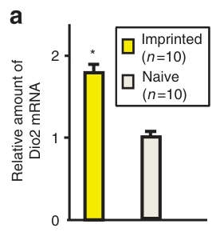
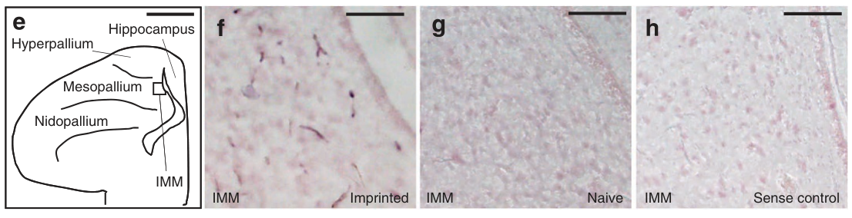
Imprinting increases brain Dio2 expression
Dio2, type 2 iodothyronine deiodinase, is an enzyme that converts T4 into T3 by removing an iodine atom. Its expression increased in the chick brain after imprinting training, coupling sensory experience to local production of an active hormone.
Trained chicks had greater Dio2 expression than chicks kept in darkness or exposed to light without imprinting. The comparison separates exposure to illumination from experience with the moving target. Dio2 labeling included the intermediate medial mesopallium, or IMM, a forebrain region involved in visual imprinting.
Learning-related hormone production therefore occurs within the developing brain. Circulating precursor can be converted where learning is occurring, and the resulting T3 changes the tissue’s capacity to acquire a preference. Experience and developmental state interact through this local biochemical step.
Yamaguchi et al. (2012), Fig. 1a. Imprinting elevates Dio2 expression.
Yamaguchi et al. (2012), Fig. 1e–h. IMM anatomy and training-associated Dio2 labeling.
Yamaguchi et al. (2012)
05
Notes:
• Dio2, type 2 iodothyronine deiodinase, is an enzyme that converts T4 into T3 by removing an iodine atom. Its expression increased in the chick brain after imprinting training, coupling sensory experience to local production of an active hormone.
• Trained chicks had greater Dio2 expression than chicks kept in darkness or exposed to light without imprinting. The comparison separates exposure to illumination from experience with the moving target. Dio2 labeling included the intermediate medial mesopallium, or IMM, a forebrain region involved in visual imprinting.
• Learning-related hormone production therefore occurs within the developing brain. Circulating precursor can be converted where learning is occurring, and the resulting T3 changes the tissue’s capacity to acquire a preference. Experience and developmental state interact through this local biochemical step.
References:
Shinji Yamaguchi, Naoya Aoki, Takaaki Kitajima, Eiji Iikubo, Sachiko Katagiri, Toshiya Matsushima, Koichi J. Homma (2012). Thyroid hormone determines the start of the sensitive period of imprinting and primes later learning. Nature Communications 3(1):1081. https://doi.org/10.1038/ncomms2088
Figure: Yamaguchi et al. (2012), Fig. 1a. Imprinting elevates Dio2 expression.
Figure source: https://doi.org/10.1038/ncomms2088
Figure: Yamaguchi et al. (2012), Fig. 1e–h. IMM anatomy and training-associated Dio2 labeling.
Figure source: https://doi.org/10.1038/ncomms2088

Slide 6
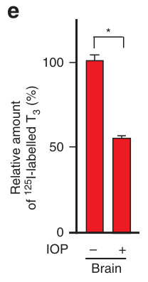
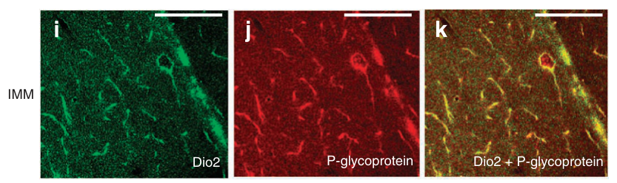
Brain capillaries convert T4 into active T3
Brain capillaries contain endothelial cells, the cells forming the vessel wall. Dio2 labeling colocalized with a capillary marker in these cells. The enzyme’s position provides a route by which blood-borne T4 can be converted into T3 near brain tissue.
The investigators followed radioactively labeled T4 and detected labeled T3 in the brain. Iopanoic acid, an inhibitor of deiodination, reduced this conversion. Blocking conversion also impaired imprinting, connecting hormone metabolism with acquisition of the familiar-object preference.
After training, brain T3 was about 1.7 times higher than in control conditions, while serum T3 did not increase comparably. Local conversion changes the hormonal signal available to brain cells without requiring an equivalent rise throughout the circulation.
Yamaguchi et al. (2012), Fig. 2e. Labeled T4 is converted into T3 in the brain.
Yamaguchi et al. (2012), Fig. 1i–k. Dio2 and a brain-capillary marker colocalize.
Yamaguchi et al. (2012)
06
Notes:
• Brain capillaries contain endothelial cells, the cells forming the vessel wall. Dio2 labeling colocalized with a capillary marker in these cells. The enzyme’s position provides a route by which blood-borne T4 can be converted into T3 near brain tissue.
• The investigators followed radioactively labeled T4 and detected labeled T3 in the brain. Iopanoic acid, an inhibitor of deiodination, reduced this conversion. Blocking conversion also impaired imprinting, connecting hormone metabolism with acquisition of the familiar-object preference.
• After training, brain T3 was about 1.7 times higher than in control conditions, while serum T3 did not increase comparably. Local conversion changes the hormonal signal available to brain cells without requiring an equivalent rise throughout the circulation.
References:
Shinji Yamaguchi, Naoya Aoki, Takaaki Kitajima, Eiji Iikubo, Sachiko Katagiri, Toshiya Matsushima, Koichi J. Homma (2012). Thyroid hormone determines the start of the sensitive period of imprinting and primes later learning. Nature Communications 3(1):1081. https://doi.org/10.1038/ncomms2088
Figure: Yamaguchi et al. (2012), Fig. 2e. Labeled T4 is converted into T3 in the brain.
Figure source: https://doi.org/10.1038/ncomms2088
Figure: Yamaguchi et al. (2012), Fig. 1i–k. Dio2 and a brain-capillary marker colocalize.
Figure source: https://doi.org/10.1038/ncomms2088

Slide 7
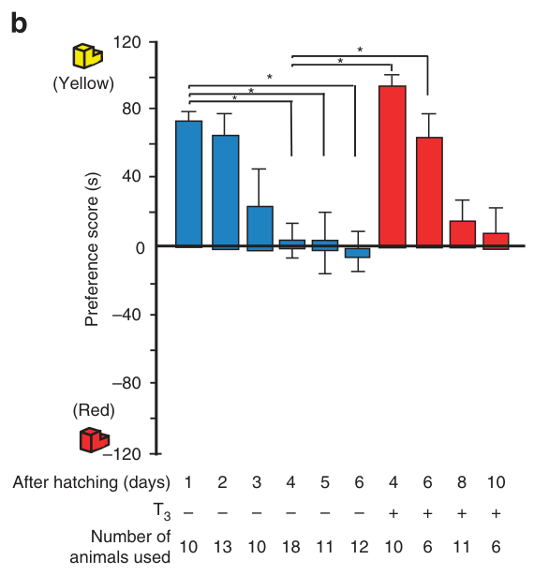
T3 restores learning within an age boundary
T3 administered 30 minutes before training restored filial imprinting in previously untrained chicks on days 4–6. Untreated chicks of these ages normally learned little under the same conditions. Hormone treatment extended the ages at which the moving object could establish a preference.
The same acute treatment was ineffective on days 8–10. This age boundary means that declining T3 is one component of the closing sensitive period, while later developmental changes further restrict responsiveness to a single hormone exposure.
Timing relative to the experience also mattered. Giving T3 before training promoted learning; administering it after training, before preference testing, did not produce the same rescue. Its effective action concerns acquisition during the encounter rather than simply increasing approach during the choice test.
Yamaguchi et al. (2012), Fig. 4b. T3 restores learning on days 4–6 but not days 8–10.
Yamaguchi et al. (2012)
07
Notes:
• T3 administered 30 minutes before training restored filial imprinting in previously untrained chicks on days 4–6. Untreated chicks of these ages normally learned little under the same conditions. Hormone treatment extended the ages at which the moving object could establish a preference.
• The same acute treatment was ineffective on days 8–10. This age boundary means that declining T3 is one component of the closing sensitive period, while later developmental changes further restrict responsiveness to a single hormone exposure.
• Timing relative to the experience also mattered. Giving T3 before training promoted learning; administering it after training, before preference testing, did not produce the same rescue. Its effective action concerns acquisition during the encounter rather than simply increasing approach during the choice test.
References:
Shinji Yamaguchi, Naoya Aoki, Takaaki Kitajima, Eiji Iikubo, Sachiko Katagiri, Toshiya Matsushima, Koichi J. Homma (2012). Thyroid hormone determines the start of the sensitive period of imprinting and primes later learning. Nature Communications 3(1):1081. https://doi.org/10.1038/ncomms2088
Figure: Yamaguchi et al. (2012), Fig. 4b. T3 restores learning on days 4–6 but not days 8–10.
Figure source: https://doi.org/10.1038/ncomms2088

Slide 8
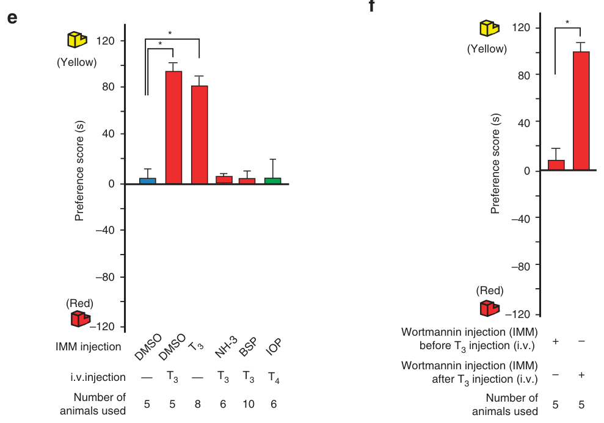
Local thyroid action changes learning capacity
T3 acts locally in the IMM to promote imprinting. Blocking thyroid-hormone receptors or hormone transport there prevented rescue of learning in older chicks. A receptor is a cellular protein that binds a signal and changes the cell’s response to it.
The PI3K inhibitor wortmannin also blocked the T3 effect. PI3K, phosphoinositide 3-kinase, participates in intracellular signaling. The authors proposed a hypothesis in which rapid thyroid signaling engages this pathway to change the IMM’s responsiveness during the training encounter.
T4 rescue additionally required conversion into T3: iopanoic acid blocked the effect of the precursor. Transport, conversion and receptor-dependent signaling are therefore separable steps connecting hormone availability to the neural processes that establish a selective visual preference.
Yamaguchi et al. (2012), Fig. 4e–f. Thyroid-receptor, transport and PI3K inhibitors block T3 action.
Yamaguchi et al. (2012), Fig. 1e–h. IMM anatomy and training-associated Dio2 labeling.
Yamaguchi et al. (2012)
08
Notes:
• T3 acts locally in the IMM to promote imprinting. Blocking thyroid-hormone receptors or hormone transport there prevented rescue of learning in older chicks. A receptor is a cellular protein that binds a signal and changes the cell’s response to it.
• The PI3K inhibitor wortmannin also blocked the T3 effect. PI3K, phosphoinositide 3-kinase, participates in intracellular signaling. The authors proposed a hypothesis in which rapid thyroid signaling engages this pathway to change the IMM’s responsiveness during the training encounter.
• T4 rescue additionally required conversion into T3: iopanoic acid blocked the effect of the precursor. Transport, conversion and receptor-dependent signaling are therefore separable steps connecting hormone availability to the neural processes that establish a selective visual preference.
References:
Shinji Yamaguchi, Naoya Aoki, Takaaki Kitajima, Eiji Iikubo, Sachiko Katagiri, Toshiya Matsushima, Koichi J. Homma (2012). Thyroid hormone determines the start of the sensitive period of imprinting and primes later learning. Nature Communications 3(1):1081. https://doi.org/10.1038/ncomms2088
Figure: Yamaguchi et al. (2012), Fig. 4e–f. Thyroid-receptor, transport and PI3K inhibitors block T3 action.
Figure source: https://doi.org/10.1038/ncomms2088
Figure: Yamaguchi et al. (2012), Fig. 1e–h. IMM anatomy and training-associated Dio2 labeling.
Figure source: https://doi.org/10.1038/ncomms2088

Slide 9
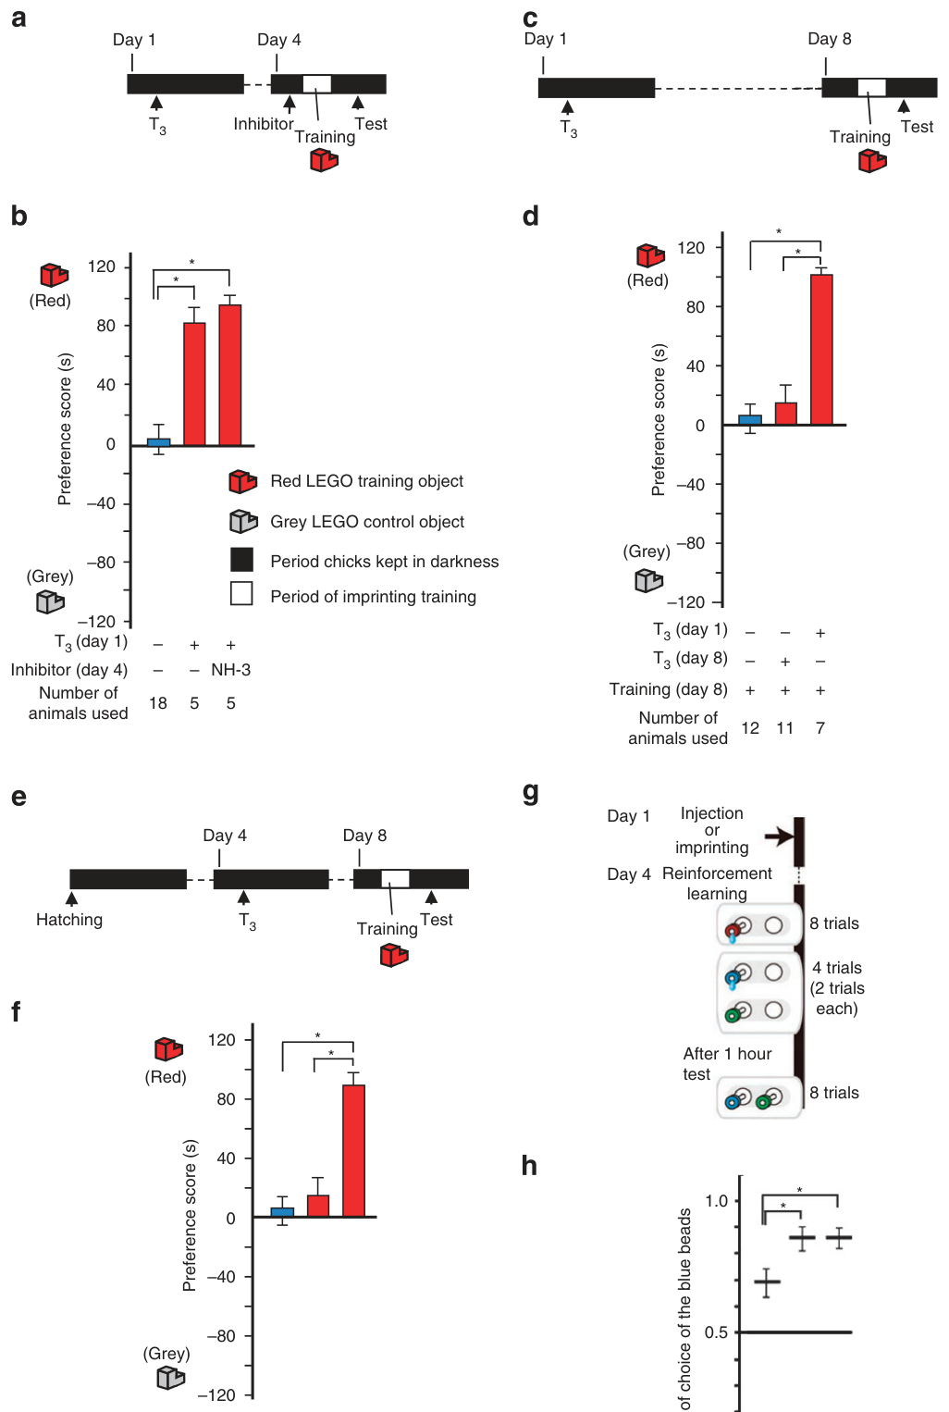
Early hormone exposure primes later learning
Priming is a lasting change that makes a later learning experience more effective. Chicks imprinted on day 1 could acquire another preference on day 4, after the normal sensitive period, while retaining the earlier preference.
T3 exposure on day 1 also permitted later imprinting even when the chicks had received no early visual training. Early hormone exposure therefore altered future learning capacity rather than merely preserving a memory of the first target.
The history of exposure mattered more than age alone. Acute T3 on day 8 was ineffective, but prior T3 treatment permitted learning at that later age. A transient developmental signal can leave a longer-lasting change in the brain’s capacity to learn from subsequent social experience.
Yamaguchi et al. (2012), Fig. 7a–h. T3 exposure primes later learning even without early imprinting.
Yamaguchi et al. (2012)
09
Notes:
• Priming is a lasting change that makes a later learning experience more effective. Chicks imprinted on day 1 could acquire another preference on day 4, after the normal sensitive period, while retaining the earlier preference.
• T3 exposure on day 1 also permitted later imprinting even when the chicks had received no early visual training. Early hormone exposure therefore altered future learning capacity rather than merely preserving a memory of the first target.
• The history of exposure mattered more than age alone. Acute T3 on day 8 was ineffective, but prior T3 treatment permitted learning at that later age. A transient developmental signal can leave a longer-lasting change in the brain’s capacity to learn from subsequent social experience.
References:
Shinji Yamaguchi, Naoya Aoki, Takaaki Kitajima, Eiji Iikubo, Sachiko Katagiri, Toshiya Matsushima, Koichi J. Homma (2012). Thyroid hormone determines the start of the sensitive period of imprinting and primes later learning. Nature Communications 3(1):1081. https://doi.org/10.1038/ncomms2088
Figure: Yamaguchi et al. (2012), Fig. 7a–h. T3 exposure primes later learning even without early imprinting.
Figure source: https://doi.org/10.1038/ncomms2088

Slide 10
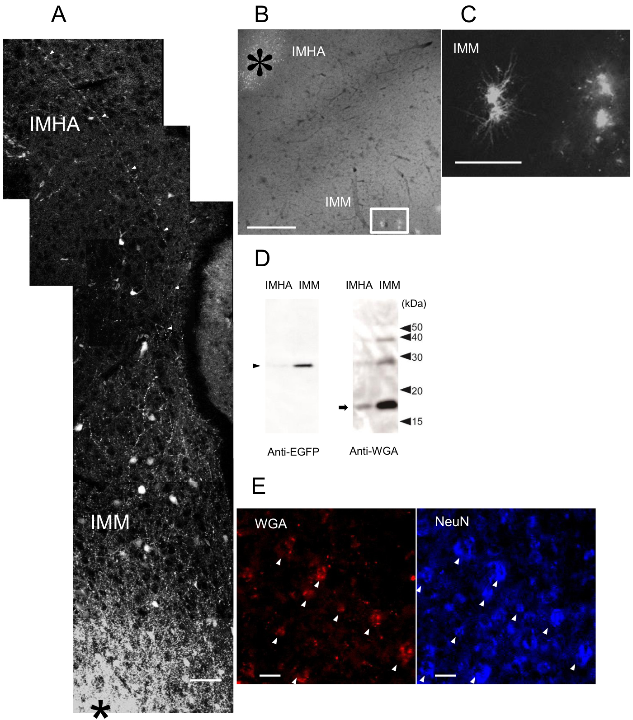
Imprinting recruits connected forebrain regions
The IMM participates in acquiring a familiar-object preference, but imprinting also involves the intermediate hyperpallium apicale, or IMHA, another forebrain region. Aoki and colleagues investigated the connection between these regions using anatomical tracing and localized lesions.
An anterograde tracer labels projections extending away from an injection site. After tracer injection into IMM, labeled axons appeared in IMHA. A retrograde tracer placed in IMHA labeled neuronal cell bodies in IMM, identifying neurons whose projections reach the injected region.
These complementary directions connect the same anatomical sites. The behavioral experiments then assigned different functions to those sites: early IMM signaling promotes learning, while an intact downstream IMHA is required for acquisition and later expression of the preference.
Aoki et al. (2015), Fig. 5A–E. Anatomical tracing and neuronal labeling connect IMM with IMHA.
Aoki et al. (2015)
10
Notes:
• The IMM participates in acquiring a familiar-object preference, but imprinting also involves the intermediate hyperpallium apicale, or IMHA, another forebrain region. Aoki and colleagues investigated the connection between these regions using anatomical tracing and localized lesions.
• An anterograde tracer labels projections extending away from an injection site. After tracer injection into IMM, labeled axons appeared in IMHA. A retrograde tracer placed in IMHA labeled neuronal cell bodies in IMM, identifying neurons whose projections reach the injected region.
• These complementary directions connect the same anatomical sites. The behavioral experiments then assigned different functions to those sites: early IMM signaling promotes learning, while an intact downstream IMHA is required for acquisition and later expression of the preference.
References:
N. Aoki, S. Yamaguchi, T. Kitajima, A. Takehara, S. Katagiri-Nakagawa, R. Matsui, D. Watanabe, T. Matsushima, K.J. Homma (2015). Critical role of the neural pathway from the intermediate medial mesopallium to the intermediate hyperpallium apicale in filial imprinting of domestic chicks (Gallus gallus domesticus). Neuroscience 308:115-124. https://doi.org/10.1016/j.neuroscience.2015.09.014
Figure: Aoki et al. (2015), Fig. 5A–E. Anatomical tracing and neuronal labeling connect IMM with IMHA.
Figure source: https://doi.org/10.1016/j.neuroscience.2015.09.014

Slide 11
Tracers identify an IMM-to-IMHA pathway
An axon is the projection through which a neuron transmits signals to other cells. Viral labeling in IMM marked axonal fibers within IMHA, providing anatomical evidence for communication between the two imprinting-related forebrain regions.
Retrograde cholera-toxin labeling from IMHA identified IMM neurons projecting toward it. Wheat-germ agglutinin, a tracer that can pass between connected cells, provided an additional measure of connectivity. Labeling in IMHA overlapped NeuN, a marker used to identify neurons.
Projection labeling and neuronal labeling answer complementary anatomical questions: which region sends fibers to the target, and whether labeled target cells are neurons. Together they support a pathway through which changes initiated in IMM can influence downstream neuronal processing in IMHA.
Aoki et al. (2015), Fig. 5A–E. Anatomical tracing and neuronal labeling connect IMM with IMHA.
Aoki et al. (2015)
11
Notes:
• An axon is the projection through which a neuron transmits signals to other cells. Viral labeling in IMM marked axonal fibers within IMHA, providing anatomical evidence for communication between the two imprinting-related forebrain regions.
• Retrograde cholera-toxin labeling from IMHA identified IMM neurons projecting toward it. Wheat-germ agglutinin, a tracer that can pass between connected cells, provided an additional measure of connectivity. Labeling in IMHA overlapped NeuN, a marker used to identify neurons.
• Projection labeling and neuronal labeling answer complementary anatomical questions: which region sends fibers to the target, and whether labeled target cells are neurons. Together they support a pathway through which changes initiated in IMM can influence downstream neuronal processing in IMHA.
References:
N. Aoki, S. Yamaguchi, T. Kitajima, A. Takehara, S. Katagiri-Nakagawa, R. Matsui, D. Watanabe, T. Matsushima, K.J. Homma (2015). Critical role of the neural pathway from the intermediate medial mesopallium to the intermediate hyperpallium apicale in filial imprinting of domestic chicks (Gallus gallus domesticus). Neuroscience 308:115-124. https://doi.org/10.1016/j.neuroscience.2015.09.014
Figure: Aoki et al. (2015), Fig. 5A–E. Anatomical tracing and neuronal labeling connect IMM with IMHA.
Figure source: https://doi.org/10.1016/j.neuroscience.2015.09.014

Slide 12
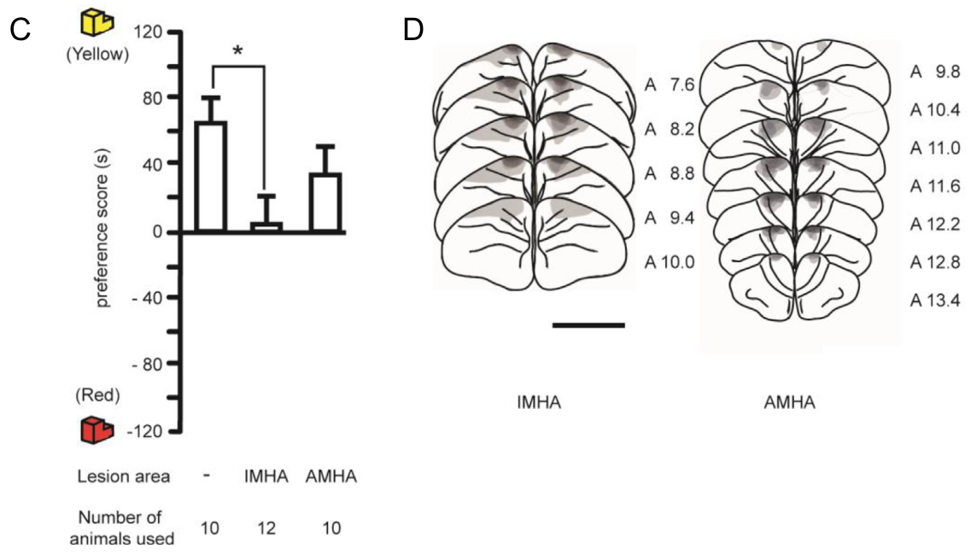
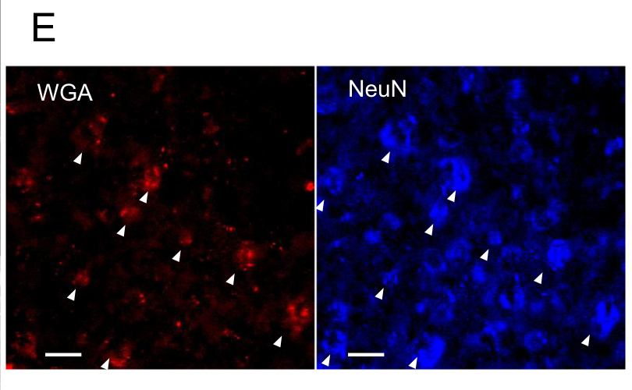
IMHA lesions disrupt preference acquisition
Chicks with IMHA lesions approached the moving training object but acquired a much weaker preference for it. Their retained approach activity separates a failure to learn target identity from a general loss of movement or willingness to follow.
The lesions were made with ibotenic acid, a compound that damages neurons near the injection site. Training consisted of two 1-hour encounters with a rotating yellow LEGO object. The choice test contrasted that object with a similarly shaped red object.
Lesions in a neighboring control region spared preference acquisition. Histological examination located the damaged tissue and checked surrounding visual-input regions. The regional comparison connects the acquisition deficit to IMHA involvement in learning the visual identity of the attachment target.
Aoki et al. (2015), Fig. 1C–D. Acquisition after regional lesions and their anatomical locations.
Aoki et al. (2015), Fig. 5E. Transsynaptic labeling overlaps the neuronal marker NeuN.
Aoki et al. (2015)
12
Notes:
• Chicks with IMHA lesions approached the moving training object but acquired a much weaker preference for it. Their retained approach activity separates a failure to learn target identity from a general loss of movement or willingness to follow.
• The lesions were made with ibotenic acid, a compound that damages neurons near the injection site. Training consisted of two 1-hour encounters with a rotating yellow LEGO object. The choice test contrasted that object with a similarly shaped red object.
• Lesions in a neighboring control region spared preference acquisition. Histological examination located the damaged tissue and checked surrounding visual-input regions. The regional comparison connects the acquisition deficit to IMHA involvement in learning the visual identity of the attachment target.
References:
N. Aoki, S. Yamaguchi, T. Kitajima, A. Takehara, S. Katagiri-Nakagawa, R. Matsui, D. Watanabe, T. Matsushima, K.J. Homma (2015). Critical role of the neural pathway from the intermediate medial mesopallium to the intermediate hyperpallium apicale in filial imprinting of domestic chicks (Gallus gallus domesticus). Neuroscience 308:115-124. https://doi.org/10.1016/j.neuroscience.2015.09.014
Figure: Aoki et al. (2015), Fig. 1C–D. Acquisition after regional lesions and their anatomical locations.
Figure source: https://doi.org/10.1016/j.neuroscience.2015.09.014
Figure: Aoki et al. (2015), Fig. 5E. Transsynaptic labeling overlaps the neuronal marker NeuN.
Figure source: https://doi.org/10.1016/j.neuroscience.2015.09.014

Slide 13
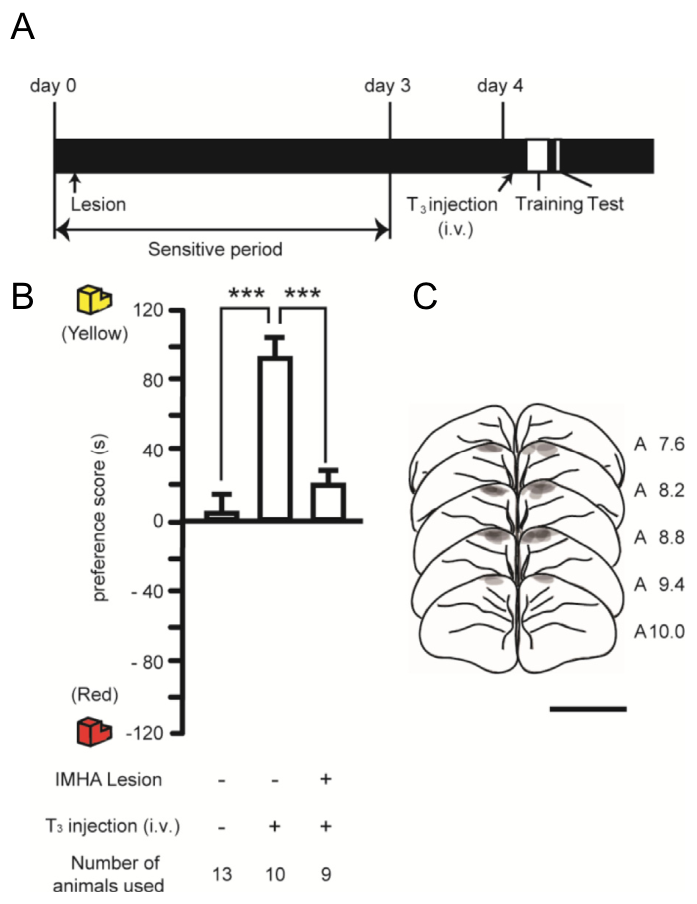
T3 rescue requires an intact downstream region
T3 given before training can restore imprinting in 4-day-old chicks. When IMHA was lesioned, the same systemic hormone treatment failed to restore a familiar-object preference. Hormone availability therefore depends on an intact neural pathway to change behavior.
The trained object was a moving yellow LEGO target, and the subsequent test measured time spent approaching yellow versus red targets. Control chicks receiving T3 developed a preference; IMHA-lesioned chicks remained poor at selecting the familiar object.
The pharmacological and anatomical manipulations affect different levels of the process. T3 changes learning capacity, while IMHA provides neural processing required to use that capacity. Increasing a permissive signal does not replace the neurons that support the resulting memory-guided choice.
Aoki et al. (2015), Fig. 3A–C. IMHA lesions block systemic T3 rescue of imprinting.
Aoki et al. (2015), Fig. 5E. Transsynaptic labeling overlaps the neuronal marker NeuN.
Aoki et al. (2015)
13
Notes:
• T3 given before training can restore imprinting in 4-day-old chicks. When IMHA was lesioned, the same systemic hormone treatment failed to restore a familiar-object preference. Hormone availability therefore depends on an intact neural pathway to change behavior.
• The trained object was a moving yellow LEGO target, and the subsequent test measured time spent approaching yellow versus red targets. Control chicks receiving T3 developed a preference; IMHA-lesioned chicks remained poor at selecting the familiar object.
• The pharmacological and anatomical manipulations affect different levels of the process. T3 changes learning capacity, while IMHA provides neural processing required to use that capacity. Increasing a permissive signal does not replace the neurons that support the resulting memory-guided choice.
References:
N. Aoki, S. Yamaguchi, T. Kitajima, A. Takehara, S. Katagiri-Nakagawa, R. Matsui, D. Watanabe, T. Matsushima, K.J. Homma (2015). Critical role of the neural pathway from the intermediate medial mesopallium to the intermediate hyperpallium apicale in filial imprinting of domestic chicks (Gallus gallus domesticus). Neuroscience 308:115-124. https://doi.org/10.1016/j.neuroscience.2015.09.014
Figure: Aoki et al. (2015), Fig. 3A–C. IMHA lesions block systemic T3 rescue of imprinting.
Figure source: https://doi.org/10.1016/j.neuroscience.2015.09.014
Figure: Aoki et al. (2015), Fig. 5E. Transsynaptic labeling overlaps the neuronal marker NeuN.
Figure source: https://doi.org/10.1016/j.neuroscience.2015.09.014

Slide 14
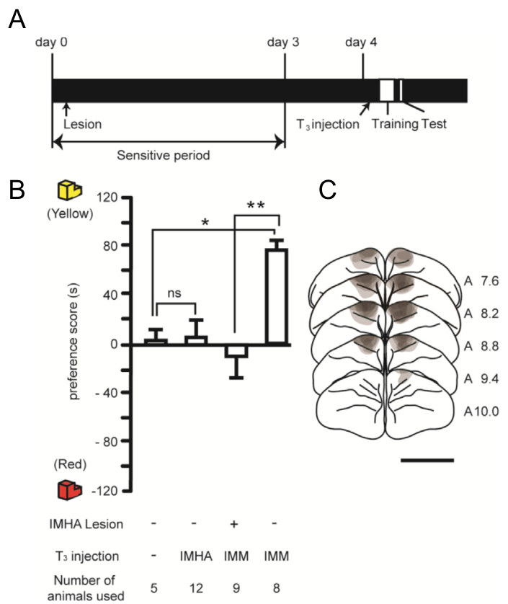
Local T3 actions differ across forebrain regions
T3 delivered directly into IMM restored imprinting in older chicks, whereas delivery into IMHA did not. The connected regions are therefore not interchangeable sites of thyroid action, despite both participating in the learned preference.
IMHA lesions also prevented rescue when T3 was injected into IMM. Local hormone action in the upstream region required the downstream region to remain intact. This combination links the effective site of hormone treatment to a second region needed for the behavioral outcome.
The authors proposed a hypothesis in which thyroid-dependent changes in IMM enable learning-related signals to reach IMHA. The results assign hormone sensitivity to IMM and behavioral dependence to IMHA, combining molecular modulation with the organization of the imprinting pathway.
Aoki et al. (2015), Fig. 4A–C. Local T3 acts in IMM and requires intact IMHA.
Aoki et al. (2015), Fig. 5E. Transsynaptic labeling overlaps the neuronal marker NeuN.
Aoki et al. (2015)
14
Notes:
• T3 delivered directly into IMM restored imprinting in older chicks, whereas delivery into IMHA did not. The connected regions are therefore not interchangeable sites of thyroid action, despite both participating in the learned preference.
• IMHA lesions also prevented rescue when T3 was injected into IMM. Local hormone action in the upstream region required the downstream region to remain intact. This combination links the effective site of hormone treatment to a second region needed for the behavioral outcome.
• The authors proposed a hypothesis in which thyroid-dependent changes in IMM enable learning-related signals to reach IMHA. The results assign hormone sensitivity to IMM and behavioral dependence to IMHA, combining molecular modulation with the organization of the imprinting pathway.
References:
N. Aoki, S. Yamaguchi, T. Kitajima, A. Takehara, S. Katagiri-Nakagawa, R. Matsui, D. Watanabe, T. Matsushima, K.J. Homma (2015). Critical role of the neural pathway from the intermediate medial mesopallium to the intermediate hyperpallium apicale in filial imprinting of domestic chicks (Gallus gallus domesticus). Neuroscience 308:115-124. https://doi.org/10.1016/j.neuroscience.2015.09.014
Figure: Aoki et al. (2015), Fig. 4A–C. Local T3 acts in IMM and requires intact IMHA.
Figure source: https://doi.org/10.1016/j.neuroscience.2015.09.014
Figure: Aoki et al. (2015), Fig. 5E. Transsynaptic labeling overlaps the neuronal marker NeuN.
Figure source: https://doi.org/10.1016/j.neuroscience.2015.09.014

Slide 15
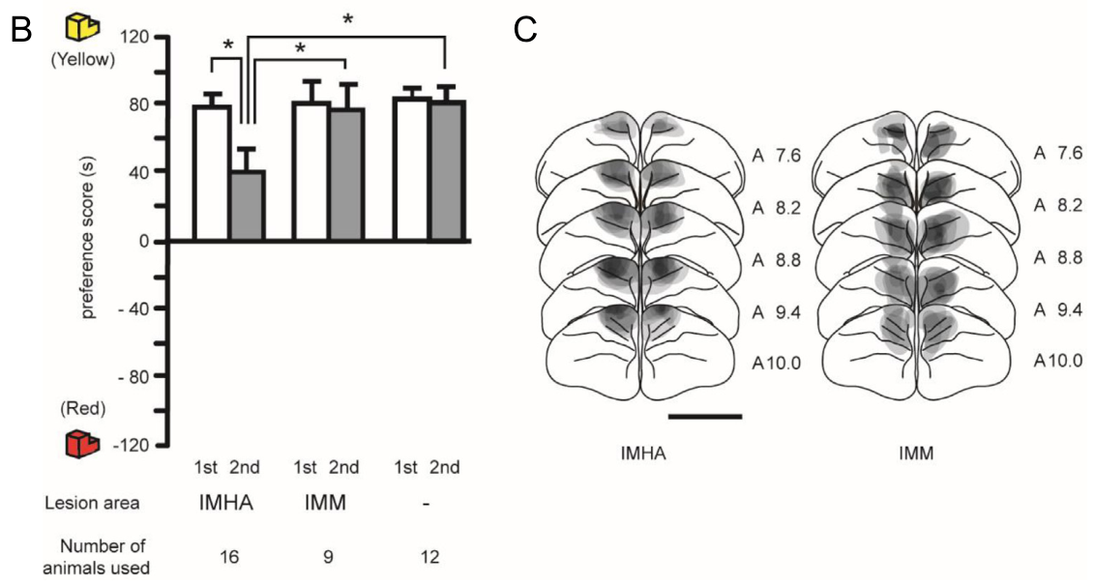
Post-training lesions disrupt later retrieval
IMHA remained necessary after a preference had already been learned. Chicks trained on day 1 were tested on day 2, lesioned after that test, and tested again on day 3. IMHA lesions reduced their subsequent familiar-object preference.
IMM lesions at this later stage spared the preference. The timing distinguishes regions required early in learning from those required once experience has already changed behavior. A region can contribute to acquisition without remaining necessary for every later retrieval.
The authors proposed that IMHA might support storage of the learned preference. Lesion-induced loss of expression establishes its involvement in later retrieval, while storage is the proposed interpretation. Developmental learning therefore changes which parts of the connected pathway remain essential for behavior.
Aoki et al. (2015), Fig. 2B–C. Recall after IMM or IMHA lesions with lesion anatomy.
Aoki et al. (2015), Fig. 5E. Transsynaptic labeling overlaps the neuronal marker NeuN.
Aoki et al. (2015)
15
Notes:
• IMHA remained necessary after a preference had already been learned. Chicks trained on day 1 were tested on day 2, lesioned after that test, and tested again on day 3. IMHA lesions reduced their subsequent familiar-object preference.
• IMM lesions at this later stage spared the preference. The timing distinguishes regions required early in learning from those required once experience has already changed behavior. A region can contribute to acquisition without remaining necessary for every later retrieval.
• The authors proposed that IMHA might support storage of the learned preference. Lesion-induced loss of expression establishes its involvement in later retrieval, while storage is the proposed interpretation. Developmental learning therefore changes which parts of the connected pathway remain essential for behavior.
References:
N. Aoki, S. Yamaguchi, T. Kitajima, A. Takehara, S. Katagiri-Nakagawa, R. Matsui, D. Watanabe, T. Matsushima, K.J. Homma (2015). Critical role of the neural pathway from the intermediate medial mesopallium to the intermediate hyperpallium apicale in filial imprinting of domestic chicks (Gallus gallus domesticus). Neuroscience 308:115-124. https://doi.org/10.1016/j.neuroscience.2015.09.014
Figure: Aoki et al. (2015), Fig. 2B–C. Recall after IMM or IMHA lesions with lesion anatomy.
Figure source: https://doi.org/10.1016/j.neuroscience.2015.09.014
Figure: Aoki et al. (2015), Fig. 5E. Transsynaptic labeling overlaps the neuronal marker NeuN.
Figure source: https://doi.org/10.1016/j.neuroscience.2015.09.014

Slide 16
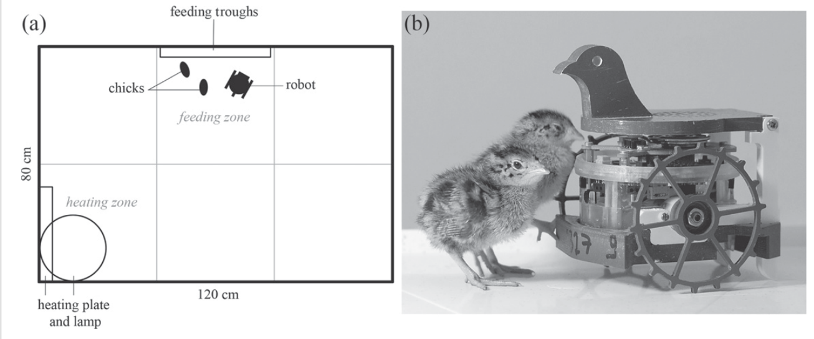
First social exposure changes robot attachment
Japanese quail chicks formed different social attachments depending on their first partner. On day 1, one group encountered another chick and a second group encountered a mobile robot. From day 2 onward, both groups lived in triads containing two chicks and one robot.
The robot carried a simplified bird-head decoy and moved through the rearing arena. Chicks first exposed to it later coordinated their behavior more strongly with the robot. Chicks first exposed to another chick coordinated more strongly with their living companion.
The identical later group composition makes the first encounter biologically significant. Subsequent access to both partners did not immediately erase the earlier difference. Early social experience selected which available partner acquired the strongest control over following and coordinated activity.
Jolly et al. (2016), Fig. 1a–b. Rearing arena and Japanese quail chicks beside a robot.
Jolly et al. (2016)
16
Notes:
• Japanese quail chicks formed different social attachments depending on their first partner. On day 1, one group encountered another chick and a second group encountered a mobile robot. From day 2 onward, both groups lived in triads containing two chicks and one robot.
• The robot carried a simplified bird-head decoy and moved through the rearing arena. Chicks first exposed to it later coordinated their behavior more strongly with the robot. Chicks first exposed to another chick coordinated more strongly with their living companion.
• The identical later group composition makes the first encounter biologically significant. Subsequent access to both partners did not immediately erase the earlier difference. Early social experience selected which available partner acquired the strongest control over following and coordinated activity.
References:
L Jolly, F Pittet, J-P Caudal, J-B Mouret, C Houdelier, S Lumineau, E de Margerie (2016). Animal-to-robot social attachment: initial requisites in a gallinaceous bird. Bioinspiration & Biomimetics 11(1):016007. https://doi.org/10.1088/1748-3190/11/1/016007
Figure: Jolly et al. (2016), Fig. 1a–b. Rearing arena and Japanese quail chicks beside a robot.
Figure source: https://doi.org/10.1088/1748-3190/11/1/016007

Slide 17
Robots provide social cues without providing care
A mobile robot can supply movement, a visible head and recorded calls without performing all functions of a parent. Jolly and colleagues used an e-puck robot with a bird-head decoy in an arena containing separate heating and feeding zones.
The robot moved at about 0.1 m/s, a speed compatible with chick following. Its autonomous program alternated exploration with pauses near heating and food. Food and warmth came from the arena rather than from the robot itself.
This separation exposes the cues supporting social attraction while maintaining the chicks’ physical needs independently. Practical interaction also required safe locomotion: the study reported a chick becoming trapped by the robot. Social responsiveness and safe operation are distinct requirements for an artificial companion.
Jolly et al. (2016), Fig. 1a–b. Rearing arena and Japanese quail chicks beside a robot.
Jolly et al. (2016)
17
Notes:
• A mobile robot can supply movement, a visible head and recorded calls without performing all functions of a parent. Jolly and colleagues used an e-puck robot with a bird-head decoy in an arena containing separate heating and feeding zones.
• The robot moved at about 0.1 m/s, a speed compatible with chick following. Its autonomous program alternated exploration with pauses near heating and food. Food and warmth came from the arena rather than from the robot itself.
• This separation exposes the cues supporting social attraction while maintaining the chicks’ physical needs independently. Practical interaction also required safe locomotion: the study reported a chick becoming trapped by the robot. Social responsiveness and safe operation are distinct requirements for an artificial companion.
References:
L Jolly, F Pittet, J-P Caudal, J-B Mouret, C Houdelier, S Lumineau, E de Margerie (2016). Animal-to-robot social attachment: initial requisites in a gallinaceous bird. Bioinspiration & Biomimetics 11(1):016007. https://doi.org/10.1088/1748-3190/11/1/016007
Figure: Jolly et al. (2016), Fig. 1a–b. Rearing arena and Japanese quail chicks beside a robot.
Figure source: https://doi.org/10.1088/1748-3190/11/1/016007

Slide 18
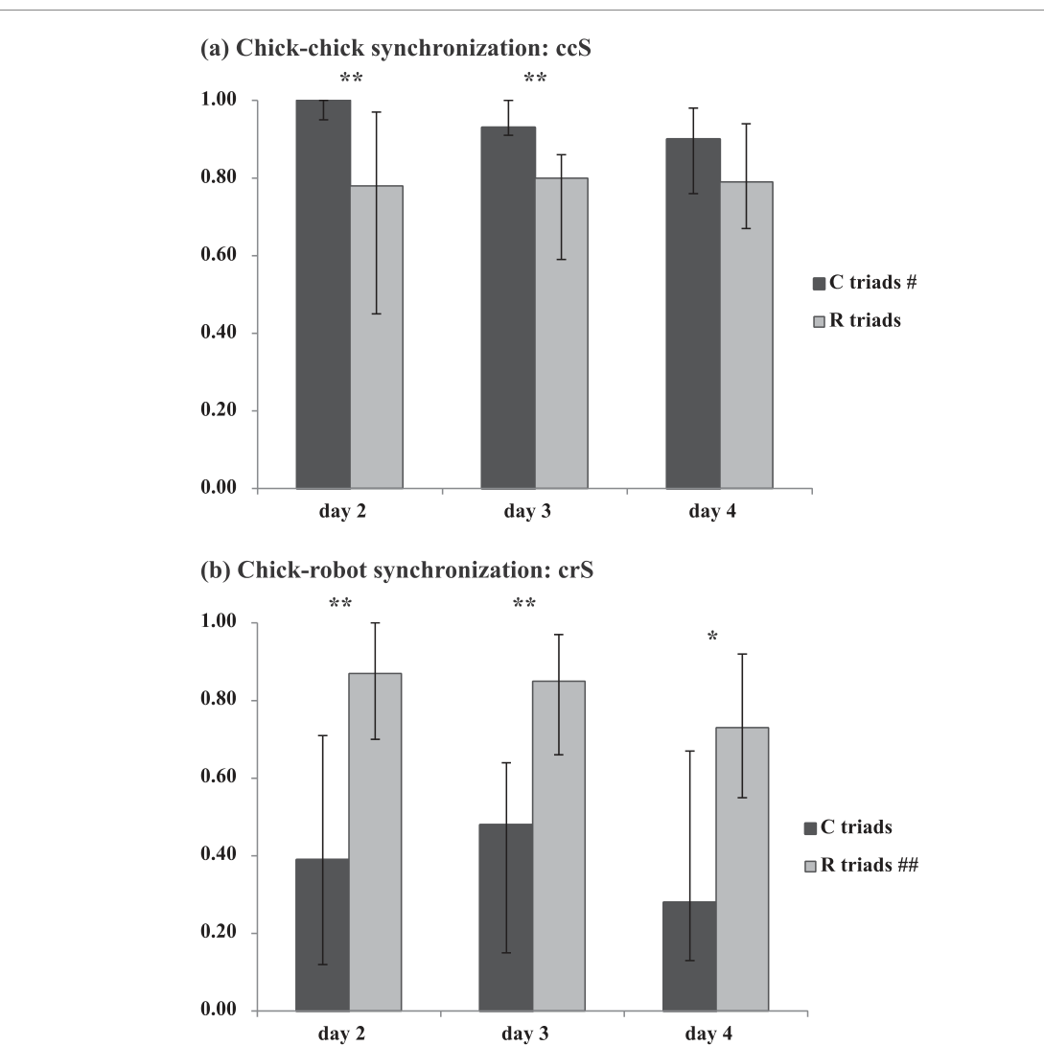
Chicks synchronize feeding with a robot
Behavioral synchronization occurs when partners perform an activity together rather than independently. The investigators recorded which arena zones chicks and robots occupied at 2-minute intervals, then quantified overlap in the feeding zone.
Robot-first chicks had stronger chick–robot feeding synchronization than chick-first animals on days 2–4. The groups nevertheless allocated broadly similar amounts of time to feeding and resting. The difference concerned which partner accompanied an activity rather than simply how much food-directed activity occurred.
The synchronization measure accounted for occupancy of the feeding zone. Its chance expectation depended on the robot’s own feeding-zone time, so simultaneous presence was interpreted relative to opportunity. Early attachment altered coordination with a particular partner during ordinary daily behavior.
Jolly et al. (2016), Fig. 3a–b. Chick–chick and chick–robot feeding synchronization.
Jolly et al. (2016)
18
Notes:
• Behavioral synchronization occurs when partners perform an activity together rather than independently. The investigators recorded which arena zones chicks and robots occupied at 2-minute intervals, then quantified overlap in the feeding zone.
• Robot-first chicks had stronger chick–robot feeding synchronization than chick-first animals on days 2–4. The groups nevertheless allocated broadly similar amounts of time to feeding and resting. The difference concerned which partner accompanied an activity rather than simply how much food-directed activity occurred.
• The synchronization measure accounted for occupancy of the feeding zone. Its chance expectation depended on the robot’s own feeding-zone time, so simultaneous presence was interpreted relative to opportunity. Early attachment altered coordination with a particular partner during ordinary daily behavior.
References:
L Jolly, F Pittet, J-P Caudal, J-B Mouret, C Houdelier, S Lumineau, E de Margerie (2016). Animal-to-robot social attachment: initial requisites in a gallinaceous bird. Bioinspiration & Biomimetics 11(1):016007. https://doi.org/10.1088/1748-3190/11/1/016007
Figure: Jolly et al. (2016), Fig. 3a–b. Chick–chick and chick–robot feeding synchronization.
Figure source: https://doi.org/10.1088/1748-3190/11/1/016007

Slide 19
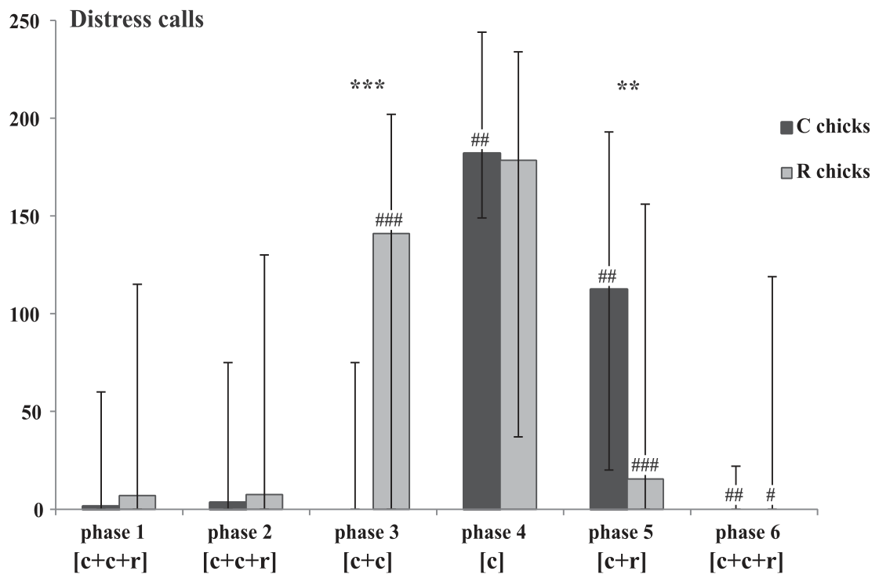
Separation calls identify a preferred partner
Distress calls increased when a quail chick lost its preferred social companion. On day 5, the researchers removed partners in a fixed sequence, counting calls during six 4-minute phases of separation and reunion.
Robot-first chicks called strongly when the robot disappeared even though their chick companion remained. Chick-first animals produced little distress at robot removal, but called when their chick partner was subsequently removed. Both groups called during complete isolation.
The remaining companion therefore did not fully replace the preferred partner. The same available chick could buffer one rearing group and fail to buffer the other. Separation responses expressed the identity of the attachment target established by the initial social encounter.
Jolly et al. (2016), Fig. 4. Distress calls during separation and reunion.
Jolly et al. (2016)
19
Notes:
• Distress calls increased when a quail chick lost its preferred social companion. On day 5, the researchers removed partners in a fixed sequence, counting calls during six 4-minute phases of separation and reunion.
• Robot-first chicks called strongly when the robot disappeared even though their chick companion remained. Chick-first animals produced little distress at robot removal, but called when their chick partner was subsequently removed. Both groups called during complete isolation.
• The remaining companion therefore did not fully replace the preferred partner. The same available chick could buffer one rearing group and fail to buffer the other. Separation responses expressed the identity of the attachment target established by the initial social encounter.
References:
L Jolly, F Pittet, J-P Caudal, J-B Mouret, C Houdelier, S Lumineau, E de Margerie (2016). Animal-to-robot social attachment: initial requisites in a gallinaceous bird. Bioinspiration & Biomimetics 11(1):016007. https://doi.org/10.1088/1748-3190/11/1/016007
Figure: Jolly et al. (2016), Fig. 4. Distress calls during separation and reunion.
Figure source: https://doi.org/10.1088/1748-3190/11/1/016007

Slide 20
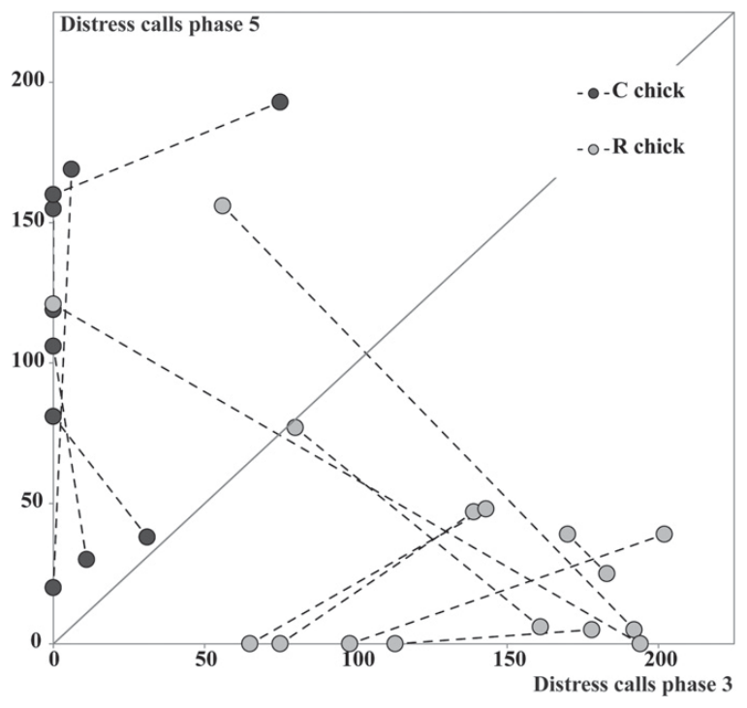
Robot reunion reduces separation distress
Returning the robot after isolation greatly reduced calling in robot-first chicks. Chick-first animals remained more distressed with only the robot present and became quiet after their living companion returned. Reunion therefore tested the capacity of a particular partner to restore social contact.
Individual chicks varied in how strongly they responded to robot removal and return. The study related each animal’s calling in those phases rather than treating attachment as an identical response in every bird. Mixed initial encounters also produced intermediate patterns.
The experiment established attachment to an artificial social partner, but whether the robot functioned as a parent or sibling was unresolved. Its presence regulated coordination and separation distress; those functions specify the attachment behavior more precisely than assigning it an untested parental role.
Jolly et al. (2016), Fig. 5. Individual responses to robot removal and return.
Jolly et al. (2016)
20
Notes:
• Returning the robot after isolation greatly reduced calling in robot-first chicks. Chick-first animals remained more distressed with only the robot present and became quiet after their living companion returned. Reunion therefore tested the capacity of a particular partner to restore social contact.
• Individual chicks varied in how strongly they responded to robot removal and return. The study related each animal’s calling in those phases rather than treating attachment as an identical response in every bird. Mixed initial encounters also produced intermediate patterns.
• The experiment established attachment to an artificial social partner, but whether the robot functioned as a parent or sibling was unresolved. Its presence regulated coordination and separation distress; those functions specify the attachment behavior more precisely than assigning it an untested parental role.
References:
L Jolly, F Pittet, J-P Caudal, J-B Mouret, C Houdelier, S Lumineau, E de Margerie (2016). Animal-to-robot social attachment: initial requisites in a gallinaceous bird. Bioinspiration & Biomimetics 11(1):016007. https://doi.org/10.1088/1748-3190/11/1/016007
Figure: Jolly et al. (2016), Fig. 5. Individual responses to robot removal and return.
Figure source: https://doi.org/10.1088/1748-3190/11/1/016007

Slide 21
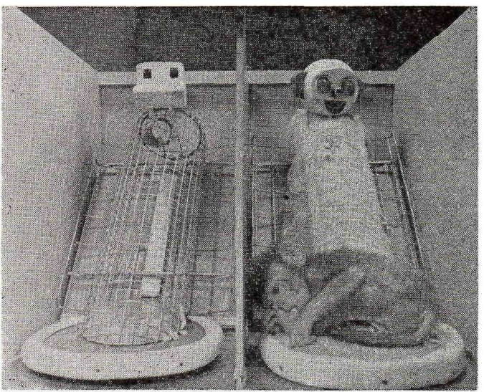
Contact comfort organizes surrogate attachment
Infant rhesus monkeys preferred prolonged contact with a soft surrogate over a wire surrogate. Contact comfort describes the soothing tactile contact obtained by clinging to the cloth-covered surface. Harlow separated this feature from the provision of milk.
The cloth surrogate had a covered, padded body that supported grasping and close contact. The wire surrogate also supported the infant and could supply milk. Each infant had access to both objects, making the preferred surface a choice within the same rearing environment.
Clinging concentrated on the cloth surrogate even when the wire surrogate supplied food. Attachment behavior therefore depended strongly on the properties of bodily contact. A substitute caregiver acquired a preferred role through sensory comfort as well as through the infant’s repeated experience with it.
Harlow (1958), Fig. 4. Wire and cloth caregiver surrogates.
Harlow (1958)
21
Notes:
• Infant rhesus monkeys preferred prolonged contact with a soft surrogate over a wire surrogate. Contact comfort describes the soothing tactile contact obtained by clinging to the cloth-covered surface. Harlow separated this feature from the provision of milk.
• The cloth surrogate had a covered, padded body that supported grasping and close contact. The wire surrogate also supported the infant and could supply milk. Each infant had access to both objects, making the preferred surface a choice within the same rearing environment.
• Clinging concentrated on the cloth surrogate even when the wire surrogate supplied food. Attachment behavior therefore depended strongly on the properties of bodily contact. A substitute caregiver acquired a preferred role through sensory comfort as well as through the infant’s repeated experience with it.
References:
Harry F. Harlow (1958). The nature of love. American Psychologist 13(12):673-685. https://doi.org/10.1037/h0047884
Figure: Harlow (1958), Fig. 4. Wire and cloth caregiver surrogates.
Figure source: https://doi.org/10.1037/h0047884

Slide 22
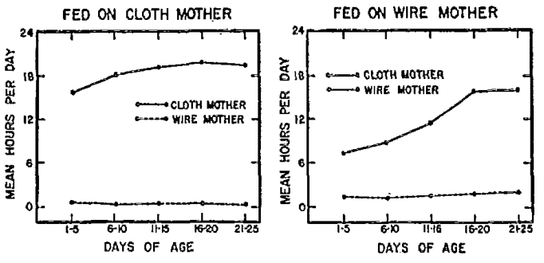
Milk source does not determine contact preference
Harlow counterbalanced feeding across surrogate types: some infants received milk from the cloth surrogate and others from the wire surrogate. This arrangement tested whether preference followed food delivery or the tactile properties of the object.
Infants in both conditions spent far more time on cloth. Wire-fed infants approached the wire surrogate to obtain milk but returned to cloth for prolonged contact. Feeding and attachment-directed contact could therefore be assigned to different objects within the same environment.
The behavioral separation explains why an object that supplies calories need not become the principal source of comfort. The infant’s actions depended on the immediate need: food directed brief visits to the nipple, while soft bodily contact maintained a much longer relationship with the cloth surrogate.
Harlow (1958), Fig. 5. Contact time when milk comes from cloth or wire.
Harlow (1958)
22
Notes:
• Harlow counterbalanced feeding across surrogate types: some infants received milk from the cloth surrogate and others from the wire surrogate. This arrangement tested whether preference followed food delivery or the tactile properties of the object.
• Infants in both conditions spent far more time on cloth. Wire-fed infants approached the wire surrogate to obtain milk but returned to cloth for prolonged contact. Feeding and attachment-directed contact could therefore be assigned to different objects within the same environment.
• The behavioral separation explains why an object that supplies calories need not become the principal source of comfort. The infant’s actions depended on the immediate need: food directed brief visits to the nipple, while soft bodily contact maintained a much longer relationship with the cloth surrogate.
References:
Harry F. Harlow (1958). The nature of love. American Psychologist 13(12):673-685. https://doi.org/10.1037/h0047884
Figure: Harlow (1958), Fig. 5. Contact time when milk comes from cloth or wire.
Figure source: https://doi.org/10.1037/h0047884

Slide 23
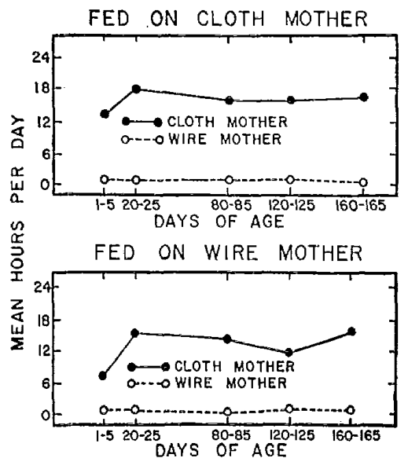
Cloth preference persists during development
The preference for cloth continued over many weeks rather than disappearing after the earliest feeding encounters. Harlow followed surrogate contact across roughly 165 days, including infants receiving milk from either surrogate type.
Cloth contact remained high under both feeding arrangements, while contact with wire remained comparatively low. Repeated access to the milk source therefore failed to transfer the prolonged-contact preference from the cloth object to the wire object.
Additional infants reared with only one surrogate had comparable milk intake and weight gain across surrogate types. Adequate feeding was compatible with very different contact experiences. Nutritional support and tactile attachment are distinct dimensions of substitute caregiving, each expressed through different patterns of infant behavior.
Harlow (1958), Fig. 6. Long-term contact preferences under counterbalanced feeding.
Harlow (1958)
23
Notes:
• The preference for cloth continued over many weeks rather than disappearing after the earliest feeding encounters. Harlow followed surrogate contact across roughly 165 days, including infants receiving milk from either surrogate type.
• Cloth contact remained high under both feeding arrangements, while contact with wire remained comparatively low. Repeated access to the milk source therefore failed to transfer the prolonged-contact preference from the cloth object to the wire object.
• Additional infants reared with only one surrogate had comparable milk intake and weight gain across surrogate types. Adequate feeding was compatible with very different contact experiences. Nutritional support and tactile attachment are distinct dimensions of substitute caregiving, each expressed through different patterns of infant behavior.
References:
Harry F. Harlow (1958). The nature of love. American Psychologist 13(12):673-685. https://doi.org/10.1037/h0047884
Figure: Harlow (1958), Fig. 6. Long-term contact preferences under counterbalanced feeding.
Figure source: https://doi.org/10.1037/h0047884

Slide 24
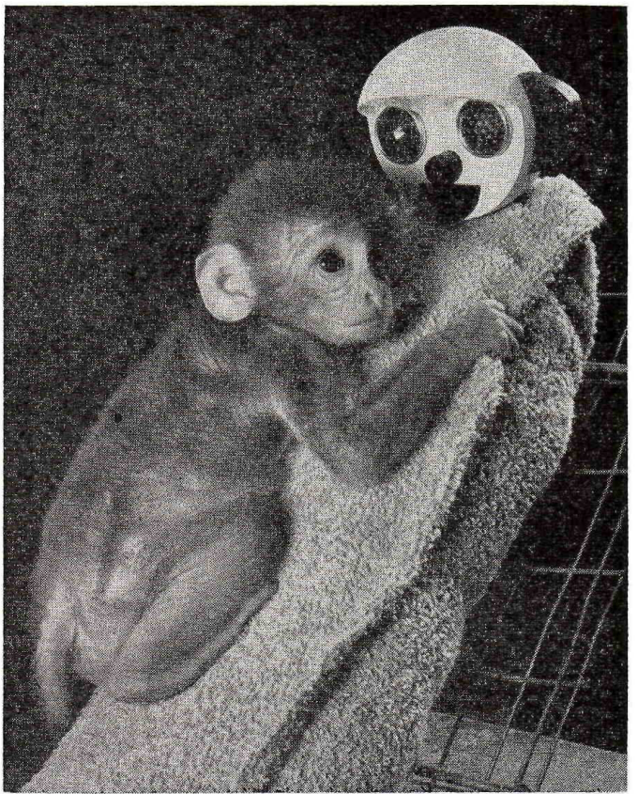
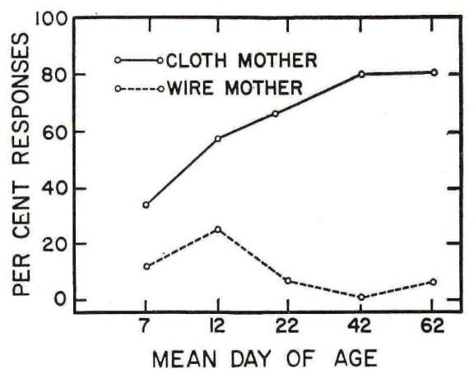
Threat directs infants toward the cloth surrogate
A frightening moving toy elicited approach to the cloth surrogate. The infant clung to its familiar soft surface rather than treating the milk-providing wire object as an equivalent refuge. The preferred caregiver regulated behavior during an acute challenge.
Harlow compared responses to the surrogates during repeated fear tests. Cloth-directed responses predominated as the infants developed. The feeding arrangement remained counterbalanced, so choosing a refuge continued to be separable from choosing a food source.
Attachment was therefore expressed in more than resting contact time. A threat reorganized the infant’s behavior toward rapid proximity and clinging to the familiar surrogate. The same object that supported prolonged everyday contact also became the target of defensive approach when the environment changed.
Harlow (1958), Fig. 14. The infant clings to the cloth surrogate during threat.
Harlow (1958), Fig. 15. Differential responses to surrogates during threat.
Harlow (1958)
24
Notes:
• A frightening moving toy elicited approach to the cloth surrogate. The infant clung to its familiar soft surface rather than treating the milk-providing wire object as an equivalent refuge. The preferred caregiver regulated behavior during an acute challenge.
• Harlow compared responses to the surrogates during repeated fear tests. Cloth-directed responses predominated as the infants developed. The feeding arrangement remained counterbalanced, so choosing a refuge continued to be separable from choosing a food source.
• Attachment was therefore expressed in more than resting contact time. A threat reorganized the infant’s behavior toward rapid proximity and clinging to the familiar surrogate. The same object that supported prolonged everyday contact also became the target of defensive approach when the environment changed.
References:
Harry F. Harlow (1958). The nature of love. American Psychologist 13(12):673-685. https://doi.org/10.1037/h0047884
Figure: Harlow (1958), Fig. 14. The infant clings to the cloth surrogate during threat.
Figure source: https://doi.org/10.1037/h0047884
Figure: Harlow (1958), Fig. 15. Differential responses to surrogates during threat.
Figure source: https://doi.org/10.1037/h0047884

Slide 25
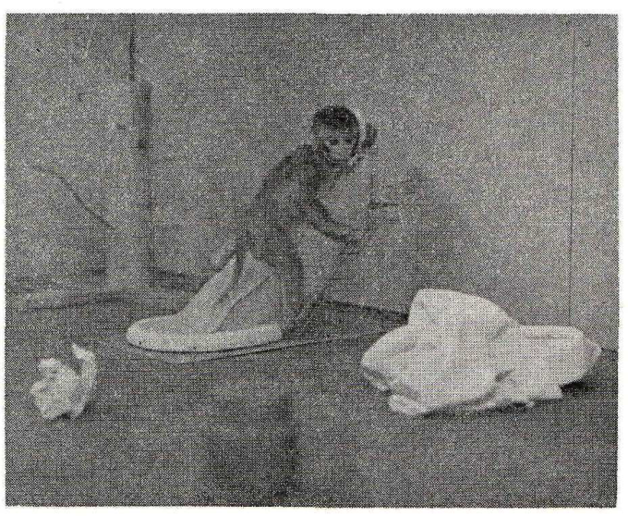
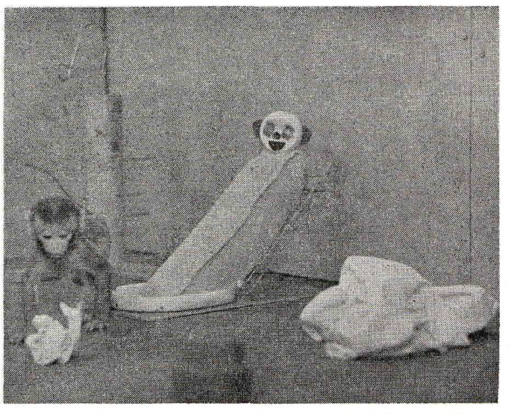
Surrogate access changes exploration
Infants placed in an unfamiliar room initially clung to the cloth surrogate and then explored nearby objects, returning periodically to contact it. The familiar object functioned as a base from which the infant could engage with an otherwise unfamiliar environment.
When the surrogate was absent, infants more often crouched, froze or vocalized rather than exploring. The open-field test lasted 3 minutes, allowing a direct comparison of behavior with and without access to the familiar attachment object.
Familiarity also affected behavior when the surrogate was visible behind a barrier. Visual access reduced distress even when physical contact was prevented, although direct contact was more effective. Tactile access and recognition of the familiar caregiver both contributed to regulation of exploration.
Harlow (1958), Fig. 16. Cloth-surrogate contact in the open field.
Harlow (1958), Fig. 17. Object exploration beside the familiar cloth surrogate.
Harlow (1958)
25
Notes:
• Infants placed in an unfamiliar room initially clung to the cloth surrogate and then explored nearby objects, returning periodically to contact it. The familiar object functioned as a base from which the infant could engage with an otherwise unfamiliar environment.
• When the surrogate was absent, infants more often crouched, froze or vocalized rather than exploring. The open-field test lasted 3 minutes, allowing a direct comparison of behavior with and without access to the familiar attachment object.
• Familiarity also affected behavior when the surrogate was visible behind a barrier. Visual access reduced distress even when physical contact was prevented, although direct contact was more effective. Tactile access and recognition of the familiar caregiver both contributed to regulation of exploration.
References:
Harry F. Harlow (1958). The nature of love. American Psychologist 13(12):673-685. https://doi.org/10.1037/h0047884
Figure: Harlow (1958), Fig. 16. Cloth-surrogate contact in the open field.
Figure source: https://doi.org/10.1037/h0047884
Figure: Harlow (1958), Fig. 17. Object exploration beside the familiar cloth surrogate.
Figure source: https://doi.org/10.1037/h0047884

Slide 26
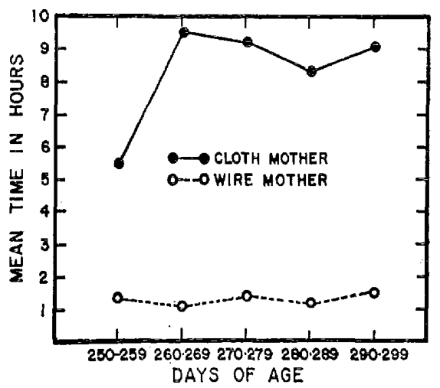
Older monkeys can form new surrogate preferences
Monkeys first given access to cloth and wire surrogates at about 250 days initially avoided the unfamiliar objects. Fear diminished with continued exposure, and the animals developed a strong preference for the cloth surrogate.
Within approximately 10 days, contact with cloth reached about 9 hours per day, while wire contact remained below 1.5 hours. The preference persisted during the ensuing observation period. An initial defensive response therefore gave way to selective attachment through repeated experience.
This later acquisition differs from the narrow early interval for untreated chick imprinting. The tactile surrogate preference remained learnable after infancy under these rearing conditions. Developmental timing depends on the behavior and the sensory relationship being learned, rather than a single universal attachment window.
Harlow (1958), Fig. 25. Cloth preference after first surrogate access at 250 days.
Harlow (1958)
26
Notes:
• Monkeys first given access to cloth and wire surrogates at about 250 days initially avoided the unfamiliar objects. Fear diminished with continued exposure, and the animals developed a strong preference for the cloth surrogate.
• Within approximately 10 days, contact with cloth reached about 9 hours per day, while wire contact remained below 1.5 hours. The preference persisted during the ensuing observation period. An initial defensive response therefore gave way to selective attachment through repeated experience.
• This later acquisition differs from the narrow early interval for untreated chick imprinting. The tactile surrogate preference remained learnable after infancy under these rearing conditions. Developmental timing depends on the behavior and the sensory relationship being learned, rather than a single universal attachment window.
References:
Harry F. Harlow (1958). The nature of love. American Psychologist 13(12):673-685. https://doi.org/10.1037/h0047884
Figure: Harlow (1958), Fig. 25. Cloth preference after first surrogate access at 250 days.
Figure source: https://doi.org/10.1037/h0047884

Slide 27
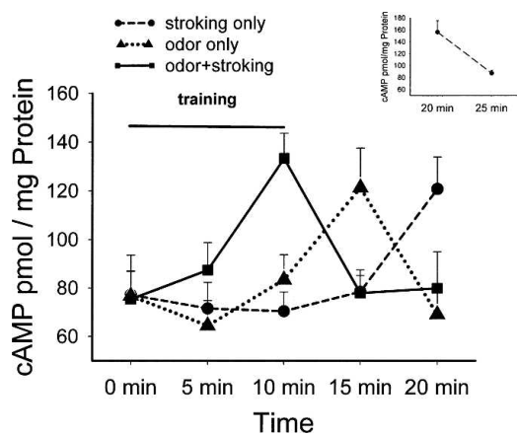
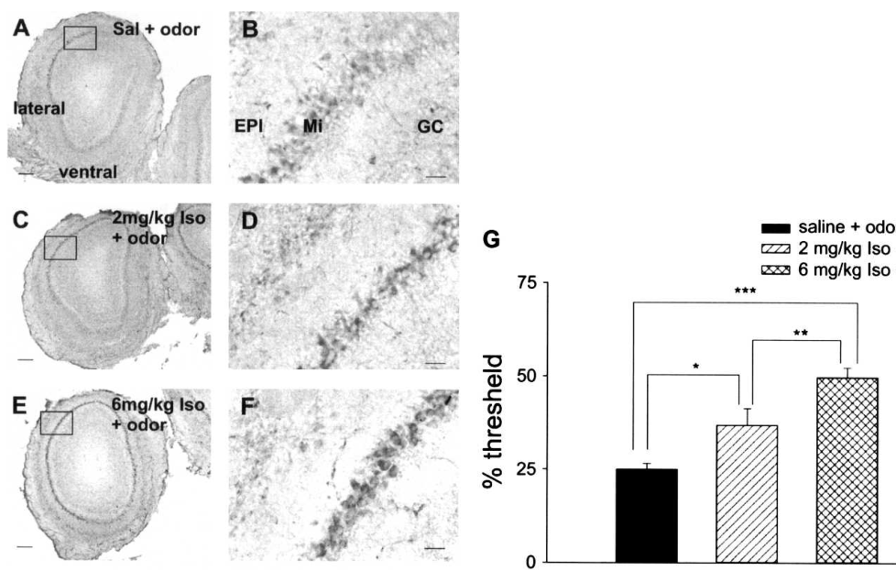
Tactile care supports learning of an odor
Young rat pups learn preferences for odors paired with tactile stimulation resembling maternal care. Cui and colleagues exposed 6-day-old pups to peppermint odor for 10 minutes while stroking them with a soft brush for alternating 30-second intervals.
The olfactory bulb is the brain structure that first processes input from odor-detecting sensory neurons. Its mitral and tufted neurons send processed odor information onward. The investigators measured cAMP, cyclic adenosine monophosphate, a chemical messenger inside cells that links stimulation to further signaling.
Paired odor and stroking produced a transient bulb cAMP increase with a rapid decline after training. Odor alone and stroking alone produced different time courses. The temporal relationship between a sensory cue and care-related stimulation therefore changes the biochemical response associated with odor learning.
Cui et al. (2007), Fig. 4. Odor and stroking jointly produce a transient cAMP increase.
Cui et al. (2007), Fig. 2A–G. cAMP staining in mitral cells and the olfactory bulb.
Cui et al. (2007)
27
Notes:
• Young rat pups learn preferences for odors paired with tactile stimulation resembling maternal care. Cui and colleagues exposed 6-day-old pups to peppermint odor for 10 minutes while stroking them with a soft brush for alternating 30-second intervals.
• The olfactory bulb is the brain structure that first processes input from odor-detecting sensory neurons. Its mitral and tufted neurons send processed odor information onward. The investigators measured cAMP, cyclic adenosine monophosphate, a chemical messenger inside cells that links stimulation to further signaling.
• Paired odor and stroking produced a transient bulb cAMP increase with a rapid decline after training. Odor alone and stroking alone produced different time courses. The temporal relationship between a sensory cue and care-related stimulation therefore changes the biochemical response associated with odor learning.
References:
Wen Cui, Andrew Smith, Andrea Darby-King, Carolyn W. Harley, John H. McLean (2007). A temporal-specific and transient cAMP increase characterizes odorant classical conditioning. Learning & Memory 14(3):126-133. https://doi.org/10.1101/lm.496007
Figure: Cui et al. (2007), Fig. 4. Odor and stroking jointly produce a transient cAMP increase.
Figure source: https://doi.org/10.1101/lm.496007
Figure: Cui et al. (2007), Fig. 2A–G. cAMP staining in mitral cells and the olfactory bulb.
Figure source: https://doi.org/10.1101/lm.496007

Slide 28
Mitral cells carry learning-related signaling
Mitral cells are projection neurons of the olfactory bulb, so changes within them can alter the odor information transmitted to other brain regions. cAMP staining identified these cells as a major location of the conditioning-related response.
After effective odor conditioning, cAMP labeling increased in mitral cells as well as in measurements of the whole bulb. The tissue images linked the biochemical change to a neuronal population rather than leaving it as an unidentified signal averaged across all cell types.
The study relates this response to CREB, a protein whose phosphorylation can regulate gene expression involved in longer-lasting neuronal changes. The proposed mechanism connects a brief care-associated cAMP signal to modifications that support a later preference for the odor paired with that experience.
Cui et al. (2007), Fig. 2A–G. cAMP staining in mitral cells and the olfactory bulb.
Cui et al. (2007)
28
Notes:
• Mitral cells are projection neurons of the olfactory bulb, so changes within them can alter the odor information transmitted to other brain regions. cAMP staining identified these cells as a major location of the conditioning-related response.
• After effective odor conditioning, cAMP labeling increased in mitral cells as well as in measurements of the whole bulb. The tissue images linked the biochemical change to a neuronal population rather than leaving it as an unidentified signal averaged across all cell types.
• The study relates this response to CREB, a protein whose phosphorylation can regulate gene expression involved in longer-lasting neuronal changes. The proposed mechanism connects a brief care-associated cAMP signal to modifications that support a later preference for the odor paired with that experience.
References:
Wen Cui, Andrew Smith, Andrea Darby-King, Carolyn W. Harley, John H. McLean (2007). A temporal-specific and transient cAMP increase characterizes odorant classical conditioning. Learning & Memory 14(3):126-133. https://doi.org/10.1101/lm.496007
Figure: Cui et al. (2007), Fig. 2A–G. cAMP staining in mitral cells and the olfactory bulb.
Figure source: https://doi.org/10.1101/lm.496007

Slide 29
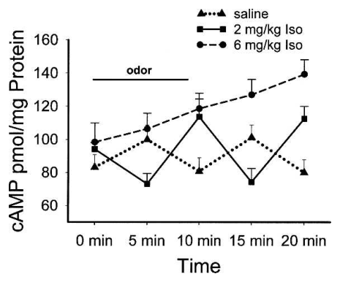
Adrenergic dose changes cAMP dynamics
Norepinephrine is a neuromodulator associated with the reinforcing effect of tactile stimulation in neonatal odor learning. The drug isoproterenol activates beta-adrenergic receptors, the receptors through which norepinephrine can stimulate cAMP production in bulb neurons.
At 2 mg/kg, isoproterenol paired with odor produced a cAMP increase near the end of the 10-minute training period, followed by a decline 5 minutes later. This dose supports odor-preference learning in the conditioning preparation.
A 6 mg/kg dose produced a larger, more sustained response but was ineffective for the learned preference. Greater messenger accumulation therefore did not correspond to stronger learning. The effective signal included both an increase and its termination, connecting receptor stimulation to a particular temporal pattern of intracellular activity.
Cui et al. (2007), Fig. 1. Dose-dependent cAMP time courses during odor conditioning.
Cui et al. (2007), Fig. 2A–G. cAMP staining in mitral cells and the olfactory bulb.
Cui et al. (2007)
29
Notes:
• Norepinephrine is a neuromodulator associated with the reinforcing effect of tactile stimulation in neonatal odor learning. The drug isoproterenol activates beta-adrenergic receptors, the receptors through which norepinephrine can stimulate cAMP production in bulb neurons.
• At 2 mg/kg, isoproterenol paired with odor produced a cAMP increase near the end of the 10-minute training period, followed by a decline 5 minutes later. This dose supports odor-preference learning in the conditioning preparation.
• A 6 mg/kg dose produced a larger, more sustained response but was ineffective for the learned preference. Greater messenger accumulation therefore did not correspond to stronger learning. The effective signal included both an increase and its termination, connecting receptor stimulation to a particular temporal pattern of intracellular activity.
References:
Wen Cui, Andrew Smith, Andrea Darby-King, Carolyn W. Harley, John H. McLean (2007). A temporal-specific and transient cAMP increase characterizes odorant classical conditioning. Learning & Memory 14(3):126-133. https://doi.org/10.1101/lm.496007
Figure: Cui et al. (2007), Fig. 1. Dose-dependent cAMP time courses during odor conditioning.
Figure source: https://doi.org/10.1101/lm.496007
Figure: Cui et al. (2007), Fig. 2A–G. cAMP staining in mitral cells and the olfactory bulb.
Figure source: https://doi.org/10.1101/lm.496007

Slide 30
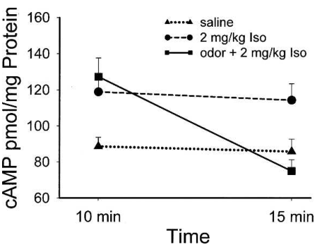
Odor pairing changes the timing of signaling
The effect of a reinforcing drug depended on whether an odor accompanied it. Cui and colleagues compared the same 2 mg/kg isoproterenol dose with and without odor exposure, measuring bulb cAMP at the end of training and shortly afterward.
Odor pairing produced an elevated response at the end of the encounter and a decline 5 minutes later. The drug alone lacked that same rise-and-fall sequence. Pharmacological receptor activation and a sensory cue therefore interacted to shape the signaling time course.
The authors proposed a hypothesis in which odor-driven calcium signals interact with beta-adrenergic signaling at adenylyl cyclase, the enzyme that produces cAMP from ATP. Coincident sensory and reinforcing inputs could thereby generate a transient messenger response that differs from either input acting alone.
Cui et al. (2007), Fig. 3. Odor pairing changes the timing of the cAMP response.
Cui et al. (2007), Fig. 2A–G. cAMP staining in mitral cells and the olfactory bulb.
Cui et al. (2007)
30
Notes:
• The effect of a reinforcing drug depended on whether an odor accompanied it. Cui and colleagues compared the same 2 mg/kg isoproterenol dose with and without odor exposure, measuring bulb cAMP at the end of training and shortly afterward.
• Odor pairing produced an elevated response at the end of the encounter and a decline 5 minutes later. The drug alone lacked that same rise-and-fall sequence. Pharmacological receptor activation and a sensory cue therefore interacted to shape the signaling time course.
• The authors proposed a hypothesis in which odor-driven calcium signals interact with beta-adrenergic signaling at adenylyl cyclase, the enzyme that produces cAMP from ATP. Coincident sensory and reinforcing inputs could thereby generate a transient messenger response that differs from either input acting alone.
References:
Wen Cui, Andrew Smith, Andrea Darby-King, Carolyn W. Harley, John H. McLean (2007). A temporal-specific and transient cAMP increase characterizes odorant classical conditioning. Learning & Memory 14(3):126-133. https://doi.org/10.1101/lm.496007
Figure: Cui et al. (2007), Fig. 3. Odor pairing changes the timing of the cAMP response.
Figure source: https://doi.org/10.1101/lm.496007
Figure: Cui et al. (2007), Fig. 2A–G. cAMP staining in mitral cells and the olfactory bulb.
Figure source: https://doi.org/10.1101/lm.496007

Slide 31
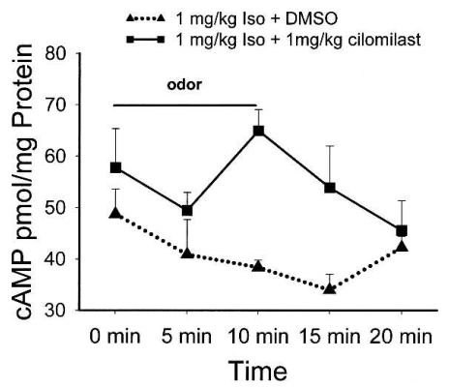
PDE4 inhibition enables a low-dose response
Phosphodiesterase 4, or PDE4, is an enzyme that breaks down cAMP. Inhibiting it changes the balance between messenger production and removal. Cui and colleagues combined the PDE4 inhibitor cilomilast with a low isoproterenol dose.
Isoproterenol at 1 mg/kg was ineffective by itself, but pairing it with 1 mg/kg cilomilast supported odor-preference learning. The combined treatment produced a training-associated cAMP increase followed by a rapid decrease after training.
Messenger degradation is therefore part of the learning-related signaling process rather than merely a passive cleanup step. Changing degradation can make weak receptor stimulation effective, yet successful treatment still preserved a transient response. Production and removal jointly determine the biochemical timing associated with acquisition of an odor preference.
Cui et al. (2007), Fig. 5. PDE4 inhibition enables a transient response at a low agonist dose.
Cui et al. (2007), Fig. 2A–G. cAMP staining in mitral cells and the olfactory bulb.
Cui et al. (2007)
31
Notes:
• Phosphodiesterase 4, or PDE4, is an enzyme that breaks down cAMP. Inhibiting it changes the balance between messenger production and removal. Cui and colleagues combined the PDE4 inhibitor cilomilast with a low isoproterenol dose.
• Isoproterenol at 1 mg/kg was ineffective by itself, but pairing it with 1 mg/kg cilomilast supported odor-preference learning. The combined treatment produced a training-associated cAMP increase followed by a rapid decrease after training.
• Messenger degradation is therefore part of the learning-related signaling process rather than merely a passive cleanup step. Changing degradation can make weak receptor stimulation effective, yet successful treatment still preserved a transient response. Production and removal jointly determine the biochemical timing associated with acquisition of an odor preference.
References:
Wen Cui, Andrew Smith, Andrea Darby-King, Carolyn W. Harley, John H. McLean (2007). A temporal-specific and transient cAMP increase characterizes odorant classical conditioning. Learning & Memory 14(3):126-133. https://doi.org/10.1101/lm.496007
Figure: Cui et al. (2007), Fig. 5. PDE4 inhibition enables a transient response at a low agonist dose.
Figure source: https://doi.org/10.1101/lm.496007
Figure: Cui et al. (2007), Fig. 2A–G. cAMP staining in mitral cells and the olfactory bulb.
Figure source: https://doi.org/10.1101/lm.496007

Slide 32
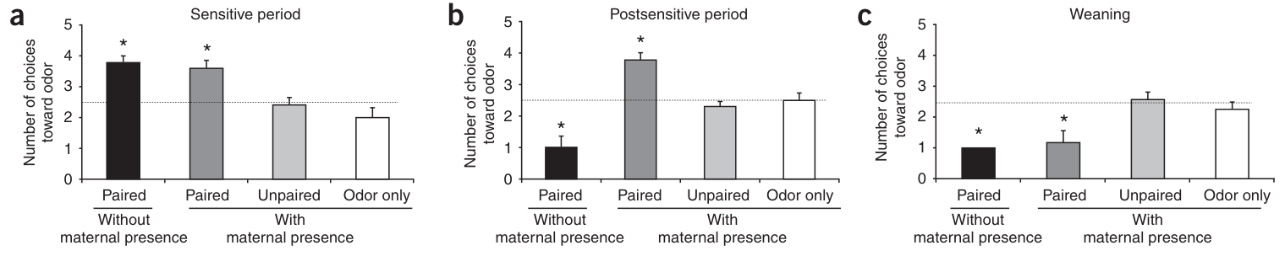
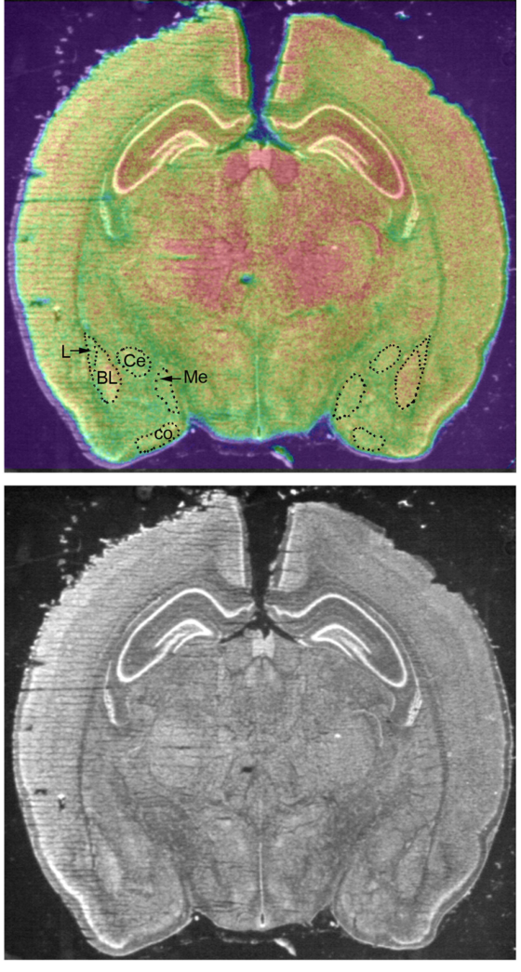
Maternal presence changes odor-shock learning
Rat pups aged 12–15 days learned to avoid an odor paired with shock when their mother was absent, but learned to approach that odor when she was present. The same sensory pairing acquired opposite behavioral significance in different social contexts.
Moriceau and Sullivan paired a 30-second peppermint presentation with a 1-second, 0.5 mA shock. The mother was anesthetized during conditioning, preventing active caregiving from explaining the difference. A next-day choice test compared the conditioned odor with familiar bedding.
Age altered this social regulation. At 8 days, pups acquired attraction with or without the mother; at 21–23 days, they acquired aversion in both conditions. Maternal regulation operated during a transitional developmental interval in which amygdala circuits supporting threat learning became accessible.
Moriceau & Sullivan (2006), Fig. 1a–c. Age and maternal presence determine attraction or aversion.
Moriceau & Sullivan (2006), Fig. Supplementary 2. Amygdala nuclei mapped onto glucose-uptake autoradiography.
Moriceau & Sullivan (2006)
32
Notes:
• Rat pups aged 12–15 days learned to avoid an odor paired with shock when their mother was absent, but learned to approach that odor when she was present. The same sensory pairing acquired opposite behavioral significance in different social contexts.
• Moriceau and Sullivan paired a 30-second peppermint presentation with a 1-second, 0.5 mA shock. The mother was anesthetized during conditioning, preventing active caregiving from explaining the difference. A next-day choice test compared the conditioned odor with familiar bedding.
• Age altered this social regulation. At 8 days, pups acquired attraction with or without the mother; at 21–23 days, they acquired aversion in both conditions. Maternal regulation operated during a transitional developmental interval in which amygdala circuits supporting threat learning became accessible.
References:
Stephanie Moriceau, Regina M Sullivan (2006). Maternal presence serves as a switch between learning fear and attraction in infancy. Nature Neuroscience 9(8):1004-1006. https://doi.org/10.1038/nn1733
Figure: Moriceau & Sullivan (2006), Fig. 1a–c. Age and maternal presence determine attraction or aversion.
Figure source: https://doi.org/10.1038/nn1733
Figure: Moriceau & Sullivan (2006), Fig. Supplementary 2. Amygdala nuclei mapped onto glucose-uptake autoradiography.
Figure source: https://doi.org/10.1038/nn1733

Slide 33
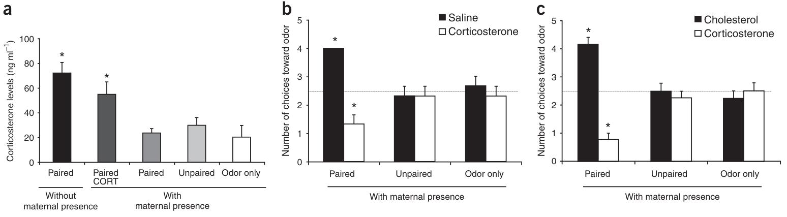
A caregiver suppresses stress-hormone signaling
Corticosterone is a glucocorticoid stress hormone in rats. During odor-shock conditioning, maternal presence reduced the pup’s corticosterone response. The social context therefore changed an internal hormonal signal as well as the later behavioral choice.
Giving corticosterone systemically before conditioning restored odor avoidance despite the mother’s presence. This manipulation connects the maternal reduction in hormone signaling to the switch from aversion to attraction during the transitional age interval.
The hormonal state regulates access to learning-related amygdala activity. A caregiver can alter what is learned about a threatening event by buffering the endocrine response during the encounter. The behavioral effect arises during conditioning rather than requiring the mother to be present during the subsequent choice test.
Moriceau & Sullivan (2006), Fig. 3a–c. Maternal buffering and corticosterone rescue of aversion.
Moriceau & Sullivan (2006), Fig. Supplementary 2. Amygdala nuclei mapped onto glucose-uptake autoradiography.
Moriceau & Sullivan (2006)
33
Notes:
• Corticosterone is a glucocorticoid stress hormone in rats. During odor-shock conditioning, maternal presence reduced the pup’s corticosterone response. The social context therefore changed an internal hormonal signal as well as the later behavioral choice.
• Giving corticosterone systemically before conditioning restored odor avoidance despite the mother’s presence. This manipulation connects the maternal reduction in hormone signaling to the switch from aversion to attraction during the transitional age interval.
• The hormonal state regulates access to learning-related amygdala activity. A caregiver can alter what is learned about a threatening event by buffering the endocrine response during the encounter. The behavioral effect arises during conditioning rather than requiring the mother to be present during the subsequent choice test.
References:
Stephanie Moriceau, Regina M Sullivan (2006). Maternal presence serves as a switch between learning fear and attraction in infancy. Nature Neuroscience 9(8):1004-1006. https://doi.org/10.1038/nn1733
Figure: Moriceau & Sullivan (2006), Fig. 3a–c. Maternal buffering and corticosterone rescue of aversion.
Figure source: https://doi.org/10.1038/nn1733
Figure: Moriceau & Sullivan (2006), Fig. Supplementary 2. Amygdala nuclei mapped onto glucose-uptake autoradiography.
Figure source: https://doi.org/10.1038/nn1733

Slide 34
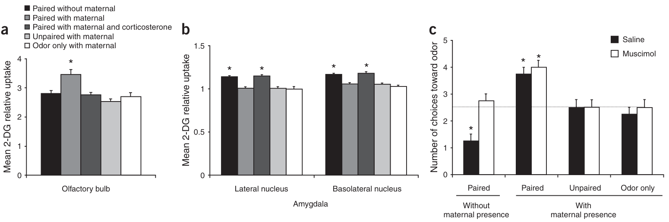
Amygdala recruitment depends on social context
The basolateral and lateral amygdala nuclei are cell groups involved in the learned significance of sensory cues. Odor-shock pairing without the mother increased metabolic activity in these nuclei, whereas pairing with her present preferentially engaged the olfactory bulb.
The investigators used labeled 2-deoxyglucose, a glucose-related compound taken up during cellular energy use. This measure localized changes in metabolic activity. Maternal presence changed which learning-related neural structures were recruited during the same conditioning procedure.
Local muscimol, a GABA-A receptor agonist that increases inhibitory receptor activity, blocked odor aversion in pups trained without the mother. It spared attraction learned with her present. Amygdala involvement therefore depended on the behavioral significance acquired by the odor, rather than all forms of odor learning requiring that region.
Moriceau & Sullivan (2006), Fig. 2a–c. Olfactory-bulb and amygdala activity with local inactivation.
Moriceau & Sullivan (2006), Fig. Supplementary 2. Amygdala nuclei mapped onto glucose-uptake autoradiography.
Moriceau & Sullivan (2006)
34
Notes:
• The basolateral and lateral amygdala nuclei are cell groups involved in the learned significance of sensory cues. Odor-shock pairing without the mother increased metabolic activity in these nuclei, whereas pairing with her present preferentially engaged the olfactory bulb.
• The investigators used labeled 2-deoxyglucose, a glucose-related compound taken up during cellular energy use. This measure localized changes in metabolic activity. Maternal presence changed which learning-related neural structures were recruited during the same conditioning procedure.
• Local muscimol, a GABA-A receptor agonist that increases inhibitory receptor activity, blocked odor aversion in pups trained without the mother. It spared attraction learned with her present. Amygdala involvement therefore depended on the behavioral significance acquired by the odor, rather than all forms of odor learning requiring that region.
References:
Stephanie Moriceau, Regina M Sullivan (2006). Maternal presence serves as a switch between learning fear and attraction in infancy. Nature Neuroscience 9(8):1004-1006. https://doi.org/10.1038/nn1733
Figure: Moriceau & Sullivan (2006), Fig. 2a–c. Olfactory-bulb and amygdala activity with local inactivation.
Figure source: https://doi.org/10.1038/nn1733
Figure: Moriceau & Sullivan (2006), Fig. Supplementary 2. Amygdala nuclei mapped onto glucose-uptake autoradiography.
Figure source: https://doi.org/10.1038/nn1733

Slide 35
Local corticosterone restores threat learning
Corticosterone delivered directly into the amygdala restored odor avoidance during conditioning with the mother present. A 50 ng local infusion changed the learning outcome even though the social cue that ordinarily buffered fear remained available.
The systemic and local manipulations converge on a mechanism: maternal presence reduces stress-hormone signaling, and corticosterone availability in the amygdala permits the odor-shock association to acquire an aversive behavioral effect.
The effect concerns a developing circuit during a particular age interval. Older pups learned aversion despite maternal presence, whereas younger pups learned attraction in both contexts. Hormonal regulation interacts with neural maturation to determine when a caregiver can switch learning between approach and avoidance.
Moriceau & Sullivan (2006), Fig. 3a–c. Maternal buffering and corticosterone rescue of aversion.
Moriceau & Sullivan (2006), Fig. Supplementary 2. Amygdala nuclei mapped onto glucose-uptake autoradiography.
Moriceau & Sullivan (2006)
35
Notes:
• Corticosterone delivered directly into the amygdala restored odor avoidance during conditioning with the mother present. A 50 ng local infusion changed the learning outcome even though the social cue that ordinarily buffered fear remained available.
• The systemic and local manipulations converge on a mechanism: maternal presence reduces stress-hormone signaling, and corticosterone availability in the amygdala permits the odor-shock association to acquire an aversive behavioral effect.
• The effect concerns a developing circuit during a particular age interval. Older pups learned aversion despite maternal presence, whereas younger pups learned attraction in both contexts. Hormonal regulation interacts with neural maturation to determine when a caregiver can switch learning between approach and avoidance.
References:
Stephanie Moriceau, Regina M Sullivan (2006). Maternal presence serves as a switch between learning fear and attraction in infancy. Nature Neuroscience 9(8):1004-1006. https://doi.org/10.1038/nn1733
Figure: Moriceau & Sullivan (2006), Fig. 3a–c. Maternal buffering and corticosterone rescue of aversion.
Figure source: https://doi.org/10.1038/nn1733
Figure: Moriceau & Sullivan (2006), Fig. Supplementary 2. Amygdala nuclei mapped onto glucose-uptake autoradiography.
Figure source: https://doi.org/10.1038/nn1733

Slide 36
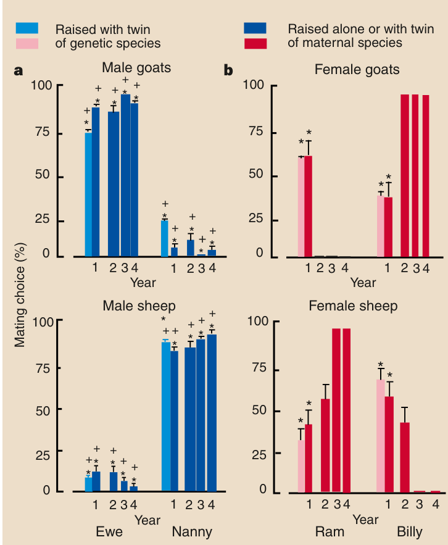
Cross-species fostering changes early experience
Cross-fostering places a newborn with a caregiver other than its biological mother. Kendrick and colleagues reciprocally fostered sheep with goat mothers and goats with sheep mothers, separating the offspring’s inherited species identity from the species of its principal early caregiver.
The fostered young also had social contact with members of their own species. Maternal species was therefore not identical to the only species available during development. Later preference tests offered animals from both species as potential social or mating partners.
Cross-fostered offspring favored partners of their maternal species, especially males. A familiar caregiver relationship influenced which adult animals subsequently attracted social approach and mating behavior, even when other developmental encounters supplied experience with the offspring’s own species.
Kendrick et al. (1998), Fig. 1a–b. Social and sexual preferences after sheep–goat cross-fostering.
Kendrick et al. (1998)
36
Notes:
• Cross-fostering places a newborn with a caregiver other than its biological mother. Kendrick and colleagues reciprocally fostered sheep with goat mothers and goats with sheep mothers, separating the offspring’s inherited species identity from the species of its principal early caregiver.
• The fostered young also had social contact with members of their own species. Maternal species was therefore not identical to the only species available during development. Later preference tests offered animals from both species as potential social or mating partners.
• Cross-fostered offspring favored partners of their maternal species, especially males. A familiar caregiver relationship influenced which adult animals subsequently attracted social approach and mating behavior, even when other developmental encounters supplied experience with the offspring’s own species.
References:
Keith M. Kendrick, Michael R. Hinton, Khia Atkins, Martin A. Haupt, John D. Skinner (1998). Mothers determine sexual preferences. Nature 395(6699):229-230. https://doi.org/10.1038/26129
Figure: Kendrick et al. (1998), Fig. 1a–b. Social and sexual preferences after sheep–goat cross-fostering.
Figure source: https://doi.org/10.1038/26129

Slide 37
Maternal attachment shapes later partner choice
Male goats raised by sheep mothers and male sheep raised by goat mothers strongly preferred females of their foster mother’s species. During adult social-choice tests, cross-fostered males spent about 89% of their time with females of the maternal species.
Mating behavior followed the same species preference. The effect was therefore expressed in both proximity to a social partner and a more specific reproductive action. Preference did not simply follow the male’s inherited species identity.
The males retained this bias after 3 years living exclusively with members of their own species. Early maternal experience established a durable target for adult attraction, while extensive later social exposure failed to redirect that preference under the conditions tested.
Kendrick et al. (1998), Fig. 1a–b. Male preferences persist after cross-species rearing.
Kendrick et al. (1998)
37
Notes:
• Male goats raised by sheep mothers and male sheep raised by goat mothers strongly preferred females of their foster mother’s species. During adult social-choice tests, cross-fostered males spent about 89% of their time with females of the maternal species.
• Mating behavior followed the same species preference. The effect was therefore expressed in both proximity to a social partner and a more specific reproductive action. Preference did not simply follow the male’s inherited species identity.
• The males retained this bias after 3 years living exclusively with members of their own species. Early maternal experience established a durable target for adult attraction, while extensive later social exposure failed to redirect that preference under the conditions tested.
References:
Keith M. Kendrick, Michael R. Hinton, Khia Atkins, Martin A. Haupt, John D. Skinner (1998). Mothers determine sexual preferences. Nature 395(6699):229-230. https://doi.org/10.1038/26129
Figure: Kendrick et al. (1998), Fig. 1a–b. Male preferences persist after cross-species rearing.
Figure source: https://doi.org/10.1038/26129

Slide 38
Cross-fostering changes selected behavioral domains
Fostered sheep and goats directed play and grooming preferentially toward animals resembling their maternal species. These affiliative activities involve choosing a partner, so an early caregiver relationship can change whom the developing animal approaches during social interaction.
Other behavior retained the offspring’s own species pattern. Aggression, climbing, feeding and vocalization were not generally transformed into the foster species’ characteristic behavior. Maternal rearing altered partner-directed affiliation more selectively than the animal’s entire behavioral repertoire.
Adult social and sexual preferences extended the early change in partner selection. Cross-fostering therefore separates learned recognition of attractive companions from inherited behavioral organization. An animal can retain species-typical actions while directing some of those actions toward a different species because of early social experience.
Kendrick et al. (1998), Fig. 1a–b. Social and sexual preferences after sheep–goat cross-fostering.
Kendrick et al. (1998)
38
Notes:
• Fostered sheep and goats directed play and grooming preferentially toward animals resembling their maternal species. These affiliative activities involve choosing a partner, so an early caregiver relationship can change whom the developing animal approaches during social interaction.
• Other behavior retained the offspring’s own species pattern. Aggression, climbing, feeding and vocalization were not generally transformed into the foster species’ characteristic behavior. Maternal rearing altered partner-directed affiliation more selectively than the animal’s entire behavioral repertoire.
• Adult social and sexual preferences extended the early change in partner selection. Cross-fostering therefore separates learned recognition of attractive companions from inherited behavioral organization. An animal can retain species-typical actions while directing some of those actions toward a different species because of early social experience.
References:
Keith M. Kendrick, Michael R. Hinton, Khia Atkins, Martin A. Haupt, John D. Skinner (1998). Mothers determine sexual preferences. Nature 395(6699):229-230. https://doi.org/10.1038/26129
Figure: Kendrick et al. (1998), Fig. 1a–b. Social and sexual preferences after sheep–goat cross-fostering.
Figure source: https://doi.org/10.1038/26129

Slide 39
Social and sexual choices require separate measures
Social preference concerns which partner an animal approaches or remains near; sexual preference concerns the target of mating behavior. Kendrick and colleagues measured both in adult sheep and goats, allowing the consequences of maternal rearing to be compared across behavioral systems.
Cross-fostered males strongly preferred the maternal species in both measures. Cross-fostered females retained some social preference but were more flexible in their sexual responses and subsequent changes in partner choice. A single proximity measure would have missed these differences.
The inherited species remained available during rearing, including situations where an opposite-sex twin was reared with its own species. Maternal attachment nevertheless influenced preference. The effect was associated with the principal early caregiver relationship rather than merely the presence of any familiar opposite-sex animal.
Kendrick et al. (1998), Fig. 1a–b. Social and sexual preferences after sheep–goat cross-fostering.
Kendrick et al. (1998)
39
Notes:
• Social preference concerns which partner an animal approaches or remains near; sexual preference concerns the target of mating behavior. Kendrick and colleagues measured both in adult sheep and goats, allowing the consequences of maternal rearing to be compared across behavioral systems.
• Cross-fostered males strongly preferred the maternal species in both measures. Cross-fostered females retained some social preference but were more flexible in their sexual responses and subsequent changes in partner choice. A single proximity measure would have missed these differences.
• The inherited species remained available during rearing, including situations where an opposite-sex twin was reared with its own species. Maternal attachment nevertheless influenced preference. The effect was associated with the principal early caregiver relationship rather than merely the presence of any familiar opposite-sex animal.
References:
Keith M. Kendrick, Michael R. Hinton, Khia Atkins, Martin A. Haupt, John D. Skinner (1998). Mothers determine sexual preferences. Nature 395(6699):229-230. https://doi.org/10.1038/26129
Figure: Kendrick et al. (1998), Fig. 1a–b. Social and sexual preferences after sheep–goat cross-fostering.
Figure source: https://doi.org/10.1038/26129

Slide 40
Female preferences change with later experience
Cross-fostered females showed weaker and more reversible maternal-species preferences than cross-fostered males. After 1–2 years of living with their own species, their choices shifted toward those later social partners.
The same rearing manipulation therefore had different persistence in the two sexes. Male preferences remained strongly biased toward the foster mother’s species after 3 years, while female preferences changed over a shorter period of subsequent conspecific contact.
Conspecifics are members of the same species. Their availability during later life supplied new social experience rather than changing the animal’s inherited identity. The sex difference concerns the continuing plasticity of partner selection: early attachment could establish a bias that later experience modified more readily in females.
Kendrick et al. (1998), Fig. 1a–b. Female preferences change with subsequent social experience.
Kendrick et al. (1998)
40
Notes:
• Cross-fostered females showed weaker and more reversible maternal-species preferences than cross-fostered males. After 1–2 years of living with their own species, their choices shifted toward those later social partners.
• The same rearing manipulation therefore had different persistence in the two sexes. Male preferences remained strongly biased toward the foster mother’s species after 3 years, while female preferences changed over a shorter period of subsequent conspecific contact.
• Conspecifics are members of the same species. Their availability during later life supplied new social experience rather than changing the animal’s inherited identity. The sex difference concerns the continuing plasticity of partner selection: early attachment could establish a bias that later experience modified more readily in females.
References:
Keith M. Kendrick, Michael R. Hinton, Khia Atkins, Martin A. Haupt, John D. Skinner (1998). Mothers determine sexual preferences. Nature 395(6699):229-230. https://doi.org/10.1038/26129
Figure: Kendrick et al. (1998), Fig. 1a–b. Female preferences change with subsequent social experience.
Figure source: https://doi.org/10.1038/26129

Slide 41
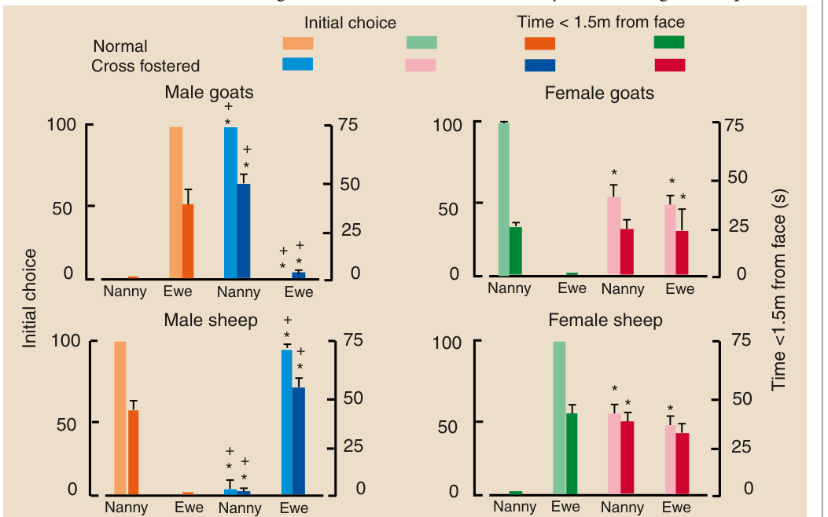
Female faces retain caregiver-species significance
Sheep and goats also chose between pictures of female faces from the two species. Cross-fostered animals preferred faces resembling their maternal species, linking adult partner selection to visual recognition as well as encounters with living partners.
The investigators recorded both the initial approach and time spent within 1.5 m of a picture during a 120-second test. Male biases were stronger than female biases, matching the broader sex difference in persistence of the rearing effect.
These visual choices identify one sensory route by which an early caregiver can influence later attraction. Familiar species-related facial features retain behavioral significance after development. Recognition of those features can direct approach even when a live partner’s movement and ongoing social interaction are absent.
Kendrick et al. (1998), Fig. 2. Preferences for female face pictures after cross-fostering.
Kendrick et al. (1998)
41
Notes:
• Sheep and goats also chose between pictures of female faces from the two species. Cross-fostered animals preferred faces resembling their maternal species, linking adult partner selection to visual recognition as well as encounters with living partners.
• The investigators recorded both the initial approach and time spent within 1.5 m of a picture during a 120-second test. Male biases were stronger than female biases, matching the broader sex difference in persistence of the rearing effect.
• These visual choices identify one sensory route by which an early caregiver can influence later attraction. Familiar species-related facial features retain behavioral significance after development. Recognition of those features can direct approach even when a live partner’s movement and ongoing social interaction are absent.
References:
Keith M. Kendrick, Michael R. Hinton, Khia Atkins, Martin A. Haupt, John D. Skinner (1998). Mothers determine sexual preferences. Nature 395(6699):229-230. https://doi.org/10.1038/26129
Figure: Kendrick et al. (1998), Fig. 2. Preferences for female face pictures after cross-fostering.
Figure source: https://doi.org/10.1038/26129

Slide 42
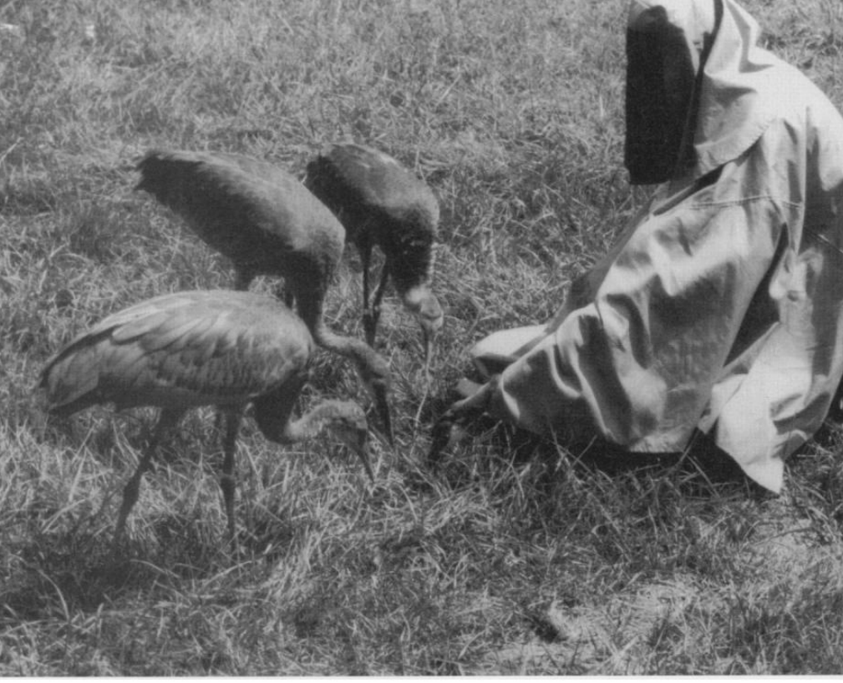
Costumed caregivers supply species-related cues
Hand-reared Mississippi sandhill cranes received care from humans wearing gray costumes and using crane-head puppets. The costumes concealed ordinary human appearance, while the puppet guided chicks toward insects and other natural food during supervised foraging.
The rearing program combined these substitutes with crane vocalizations, adult models and access to live adult cranes in adjacent pens. Substitute care therefore preserved several species-related cues rather than asking a single artificial object to replace every parental function.
The behavioral goal was competent foraging with limited attraction to ordinary humans. Caregiving could direct food discovery while its visible form emphasized crane identity. This arrangement applied knowledge of early social learning to preparation for life outside the captive rearing setting.
Ellis et al. (2000), Fig. 2. Costumed caregiver and crane-head puppet guide foraging.
Ellis et al. (2000)
42
Notes:
• Hand-reared Mississippi sandhill cranes received care from humans wearing gray costumes and using crane-head puppets. The costumes concealed ordinary human appearance, while the puppet guided chicks toward insects and other natural food during supervised foraging.
• The rearing program combined these substitutes with crane vocalizations, adult models and access to live adult cranes in adjacent pens. Substitute care therefore preserved several species-related cues rather than asking a single artificial object to replace every parental function.
• The behavioral goal was competent foraging with limited attraction to ordinary humans. Caregiving could direct food discovery while its visible form emphasized crane identity. This arrangement applied knowledge of early social learning to preparation for life outside the captive rearing setting.
References:
David H. Ellis, George F. Gee, Scott G. Hereford, Glenn H. Olsen, T. David Chisolm, Jane M. Nicolich, Kathleen A. Sullivan, Nancy J. Thomas, Meenakshi Nagendran, Jeff S. Hatfield (2000). Post-Release Survival of Hand-Reared and Parent-Reared Mississippi Sandhill Cranes. The Condor 102(1):104-112. https://doi.org/10.1093/condor/102.1.104
Figure: Ellis et al. (2000), Fig. 2. Costumed caregiver and crane-head puppet guide foraging.
Figure source: https://doi.org/10.1093/condor/102.1.104

Slide 43
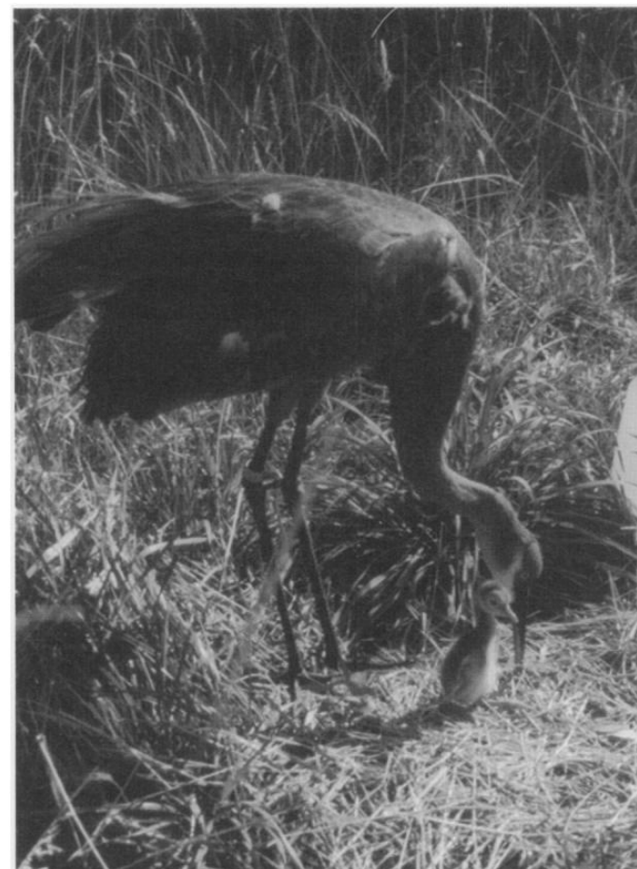
Release exposes juveniles to a natural social setting
Parent-reared cranes learned with biological or foster crane parents, whereas hand-reared cranes received costume and puppet care. Both rearing methods were followed by preparation for release into the Mississippi refuge, where survival required natural foraging and avoidance of hazards.
Juveniles were assigned to hand-reared, parent-reared or mixed release groups. The groups stayed together before transport and spent about a month in a refuge acclimation enclosure. Wild cranes visited the release pens, providing contact with the receiving population.
Temporary wing restraints were removed before free release. Radio tracking then followed the birds beyond the controlled enclosure. The transition combined early caregiving history, juvenile social companions and experience of the release environment, all of which could influence subsequent behavior in the wild.
Ellis et al. (2000), Fig. 1. Parent-reared cranes learn foraging from adult cranes.
Ellis et al. (2000)
43
Notes:
• Parent-reared cranes learned with biological or foster crane parents, whereas hand-reared cranes received costume and puppet care. Both rearing methods were followed by preparation for release into the Mississippi refuge, where survival required natural foraging and avoidance of hazards.
• Juveniles were assigned to hand-reared, parent-reared or mixed release groups. The groups stayed together before transport and spent about a month in a refuge acclimation enclosure. Wild cranes visited the release pens, providing contact with the receiving population.
• Temporary wing restraints were removed before free release. Radio tracking then followed the birds beyond the controlled enclosure. The transition combined early caregiving history, juvenile social companions and experience of the release environment, all of which could influence subsequent behavior in the wild.
References:
David H. Ellis, George F. Gee, Scott G. Hereford, Glenn H. Olsen, T. David Chisolm, Jane M. Nicolich, Kathleen A. Sullivan, Nancy J. Thomas, Meenakshi Nagendran, Jeff S. Hatfield (2000). Post-Release Survival of Hand-Reared and Parent-Reared Mississippi Sandhill Cranes. The Condor 102(1):104-112. https://doi.org/10.1093/condor/102.1.104
Figure: Ellis et al. (2000), Fig. 1. Parent-reared cranes learn foraging from adult cranes.
Figure source: https://doi.org/10.1093/condor/102.1.104

Slide 44
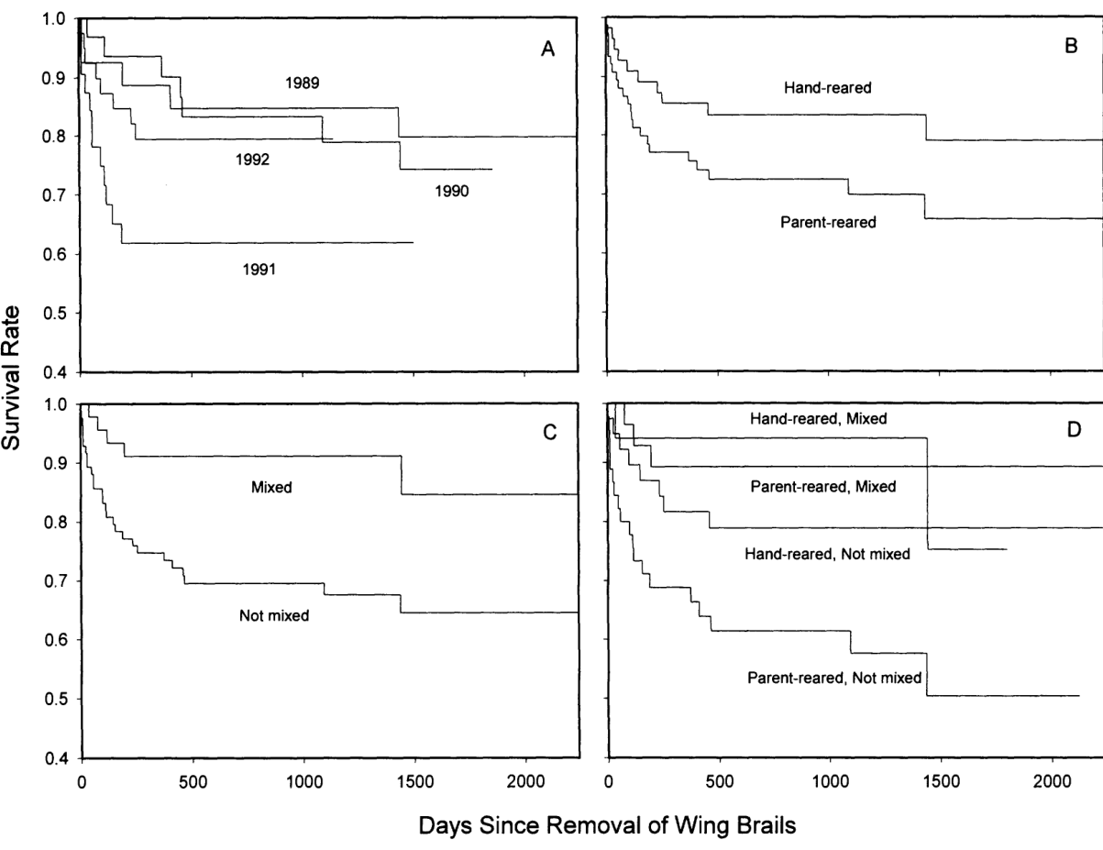
Survival tests the consequences of rearing
Estimated survival during the first year after release was about 80% across the crane rearing treatments. Hand-reared birds survived at least as well as parent-reared birds under the costume-rearing and release procedures used by Ellis and colleagues.
The comparison evaluated an outcome beyond attachment or performance in a captive test. Free-ranging birds had to find food, move through habitat and respond to predators. Successful hand rearing therefore required development of behavior compatible with those natural demands.
Radio transmitters could fail before a bird died, and some cranes reappeared more than 2 years after last detection. The investigators distinguished disappearance from confirmed mortality when estimating survival. This distinction changes how field outcomes are interpreted: loss of a signal is not equivalent to loss of the animal.
Ellis et al. (2000), Fig. 3A–D. Post-release survival of hand-reared and parent-reared cranes.
Ellis et al. (2000)
44
Notes:
• Estimated survival during the first year after release was about 80% across the crane rearing treatments. Hand-reared birds survived at least as well as parent-reared birds under the costume-rearing and release procedures used by Ellis and colleagues.
• The comparison evaluated an outcome beyond attachment or performance in a captive test. Free-ranging birds had to find food, move through habitat and respond to predators. Successful hand rearing therefore required development of behavior compatible with those natural demands.
• Radio transmitters could fail before a bird died, and some cranes reappeared more than 2 years after last detection. The investigators distinguished disappearance from confirmed mortality when estimating survival. This distinction changes how field outcomes are interpreted: loss of a signal is not equivalent to loss of the animal.
References:
David H. Ellis, George F. Gee, Scott G. Hereford, Glenn H. Olsen, T. David Chisolm, Jane M. Nicolich, Kathleen A. Sullivan, Nancy J. Thomas, Meenakshi Nagendran, Jeff S. Hatfield (2000). Post-Release Survival of Hand-Reared and Parent-Reared Mississippi Sandhill Cranes. The Condor 102(1):104-112. https://doi.org/10.1093/condor/102.1.104
Figure: Ellis et al. (2000), Fig. 3A–D. Post-release survival of hand-reared and parent-reared cranes.
Figure source: https://doi.org/10.1093/condor/102.1.104

Slide 45
Mixed cohorts improve post-release survival
Cranes released in mixed hand-reared and parent-reared cohorts survived better than birds released in unmixed cohorts. Parent-reared birds benefited particularly strongly from mixed groups, connecting the social composition of release to a later field outcome.
The authors proposed a hypothesis that the groups combined different behavioral strengths. Parent-reared cranes could contribute natural foraging skills, whereas costume-reared birds might be more wary of ordinary humans because their caregivers had concealed human appearance.
These proposed mechanisms concern social learning and responses to potential danger after release. The measured result is the survival advantage of mixed cohorts. A substitute-care program can therefore include later opportunities for learning from peers with different early experience, rather than depending entirely on the original surrogate caregiver.
Ellis et al. (2000), Fig. 3A–D. Release cohorts, rearing history and post-release survival.
Ellis et al. (2000)
45
Notes:
• Cranes released in mixed hand-reared and parent-reared cohorts survived better than birds released in unmixed cohorts. Parent-reared birds benefited particularly strongly from mixed groups, connecting the social composition of release to a later field outcome.
• The authors proposed a hypothesis that the groups combined different behavioral strengths. Parent-reared cranes could contribute natural foraging skills, whereas costume-reared birds might be more wary of ordinary humans because their caregivers had concealed human appearance.
• These proposed mechanisms concern social learning and responses to potential danger after release. The measured result is the survival advantage of mixed cohorts. A substitute-care program can therefore include later opportunities for learning from peers with different early experience, rather than depending entirely on the original surrogate caregiver.
References:
David H. Ellis, George F. Gee, Scott G. Hereford, Glenn H. Olsen, T. David Chisolm, Jane M. Nicolich, Kathleen A. Sullivan, Nancy J. Thomas, Meenakshi Nagendran, Jeff S. Hatfield (2000). Post-Release Survival of Hand-Reared and Parent-Reared Mississippi Sandhill Cranes. The Condor 102(1):104-112. https://doi.org/10.1093/condor/102.1.104
Figure: Ellis et al. (2000), Fig. 3A–D. Release cohorts, rearing history and post-release survival.
Figure source: https://doi.org/10.1093/condor/102.1.104

Slide 46
Key takeaways
Learned target identity Early social experience gives particular visual or olfactory cues selective control over approach, following and attachment behavior.
Hormonal timing Local T4-to-T3 conversion promotes chick imprinting, and early T3 exposure primes later learning beyond the usual sensitive period.
Connected forebrain functions T3 acts effectively in IMM, an intact IMHA is required downstream, and post-training IMHA lesions disrupt later preference expression.
Attachment cues Cloth contact attracts rhesus infants independently of milk, while early robot exposure changes quail coordination and separation distress.
Caregiver regulation Transient olfactory-bulb cAMP accompanies effective neonatal odor conditioning; maternal corticosterone buffering changes amygdala-dependent threat learning.
Development and later social experience Cross-fostering alters partner preferences with sex-dependent persistence, and mixed crane release cohorts improve survival after substitute care.
Yamaguchi et al. (2012); Aoki et al. (2015); Harlow (1958); Jolly et al. (2016); Cui et al. (2007); Moriceau & Sullivan (2006); Kendrick et al. (1998); Ellis et al. (2000)
46
Notes:
Harry F. Harlow (1958). The nature of love. American Psychologist 13(12):673-685. https://doi.org/10.1037/h0047884
Shinji Yamaguchi, Naoya Aoki, Takaaki Kitajima, Eiji Iikubo, Sachiko Katagiri, Toshiya Matsushima, Koichi J. Homma (2012). Thyroid hormone determines the start of the sensitive period of imprinting and primes later learning. Nature Communications 3(1):1081. https://doi.org/10.1038/ncomms2088
N. Aoki, S. Yamaguchi, T. Kitajima, A. Takehara, S. Katagiri-Nakagawa, R. Matsui, D. Watanabe, T. Matsushima, K.J. Homma (2015). Critical role of the neural pathway from the intermediate medial mesopallium to the intermediate hyperpallium apicale in filial imprinting of domestic chicks (Gallus gallus domesticus). Neuroscience 308:115-124. https://doi.org/10.1016/j.neuroscience.2015.09.014
L Jolly, F Pittet, J-P Caudal, J-B Mouret, C Houdelier, S Lumineau, E de Margerie (2016). Animal-to-robot social attachment: initial requisites in a gallinaceous bird. Bioinspiration & Biomimetics 11(1):016007. https://doi.org/10.1088/1748-3190/11/1/016007
Wen Cui, Andrew Smith, Andrea Darby-King, Carolyn W. Harley, John H. McLean (2007). A temporal-specific and transient cAMP increase characterizes odorant classical conditioning. Learning & Memory 14(3):126-133. https://doi.org/10.1101/lm.496007
Stephanie Moriceau, Regina M Sullivan (2006). Maternal presence serves as a switch between learning fear and attraction in infancy. Nature Neuroscience 9(8):1004-1006. https://doi.org/10.1038/nn1733
Keith M. Kendrick, Michael R. Hinton, Khia Atkins, Martin A. Haupt, John D. Skinner (1998). Mothers determine sexual preferences. Nature 395(6699):229-230. https://doi.org/10.1038/26129
David H. Ellis, George F. Gee, Scott G. Hereford, Glenn H. Olsen, T. David Chisolm, Jane M. Nicolich, Kathleen A. Sullivan, Nancy J. Thomas, Meenakshi Nagendran, Jeff S. Hatfield (2000). Post-Release Survival of Hand-Reared and Parent-Reared Mississippi Sandhill Cranes. The Condor 102(1):104-112. https://doi.org/10.1093/condor/102.1.104

