Slide 1
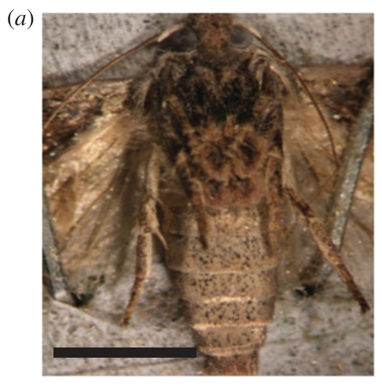
NEUR 411 · NEUROETHOLOGY · FALL 2026
Lecture 15
Insect hearing II:
moth ears and bat-evasion behavior (Roeder)
Monday, September 28, 2026
Jordan Lopez, Ph.D.
Professor of Neurobiology & Biomedical Engineering
Moir et al. (2013), Fig. 1(a). Greater wax moth; scale bar 5 mm.
Notes:
Insect hearing II: moth ears and bat-evasion behavior (Roeder)
Lecture 15. NEUR 411 · NEUROETHOLOGY · FALL 2026. Monday, September 28, 2026.
Figure: Moir et al. (2013), Fig. 1(a). Greater wax moth; scale bar 5 mm.
Figure source: https://doi.org/10.1098/rsbl.2013.0241
References:
Moir HM, Jackson JC, Windmill JFC (2013). Extremely high frequency sensitivity in a ‘simple’ ear. Biology Letters 9: 20130241. https://doi.org/10.1098/rsbl.2013.0241

Slide 2
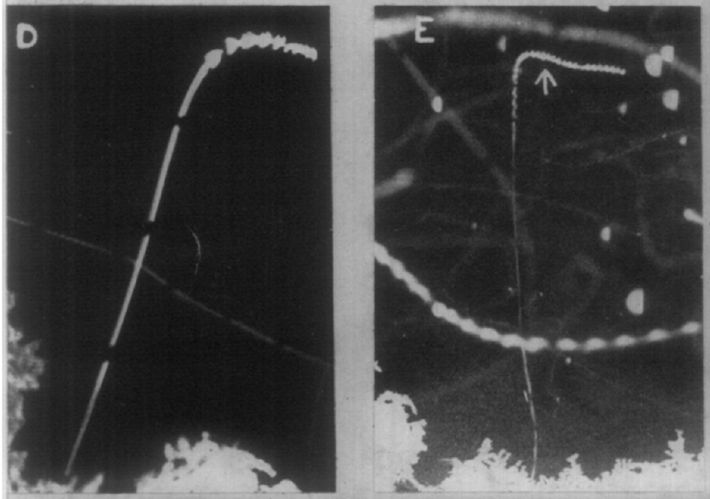
Ultrasound changes the flight of unrestrained moths
Free-flying moths exposed to artificial ultrasound, sound above the human audible range, changed course or stopped beating their wings. Roeder photographed these responses on an open lawn rather than restricting the insects to a wire or tether.
A marker flash identified stimulus onset, and interruptions in the photographic tracks provided a 0.25-s time base. Flash-only trials caused no flight deviation; enclosing the camera reduced unwanted ultrasound from its shutter.
Some moths made passive dives with motionless wings, whereas others continued powered flight. Recorded reaction times ranged from 0.2 s to more than 1 s. These field observations establish ultrasound-evoked flight changes, but bright illumination and incomplete species identification limit conclusions about natural darkness and species-specific responses.
Roeder (1962), Fig. 1(D–E). Passive moth dives; gaps mark 0.25 s.
Roeder (1962)
02
Notes:
• Free-flying moths exposed to artificial **ultrasound**, sound above the human audible range, changed course or stopped beating their wings. Roeder photographed these responses on an open lawn rather than restricting the insects to a wire or tether.
• A marker flash identified stimulus onset, and interruptions in the photographic tracks provided a 0.25-s time base. Flash-only trials caused no flight deviation; enclosing the camera reduced unwanted ultrasound from its shutter.
– A stationary-flight preparation can constrain turning and may already disturb the animal. Roeder instead examined insects entering the sound field during their own flights. The timing control separates the effect of ultrasound from the visible flash used to mark its onset.
• Some moths made passive dives with motionless wings, whereas others continued powered flight. Recorded reaction times ranged from 0.2 s to more than 1 s. These field observations establish ultrasound-evoked flight changes, but bright illumination and incomplete species identification limit conclusions about natural darkness and species-specific responses.
References:
Roeder KD (1962). The behaviour of free flying moths in the presence of artificial ultrasonic pulses. Animal Behaviour 10: 300-304. https://doi.org/10.1016/0003-3472(62)90053-2
Figure: Roeder (1962), Fig. 1(D–E). Passive moth dives; gaps mark 0.25 s.
Figure source: https://doi.org/10.1016/0003-3472(62)90053-2

Slide 3
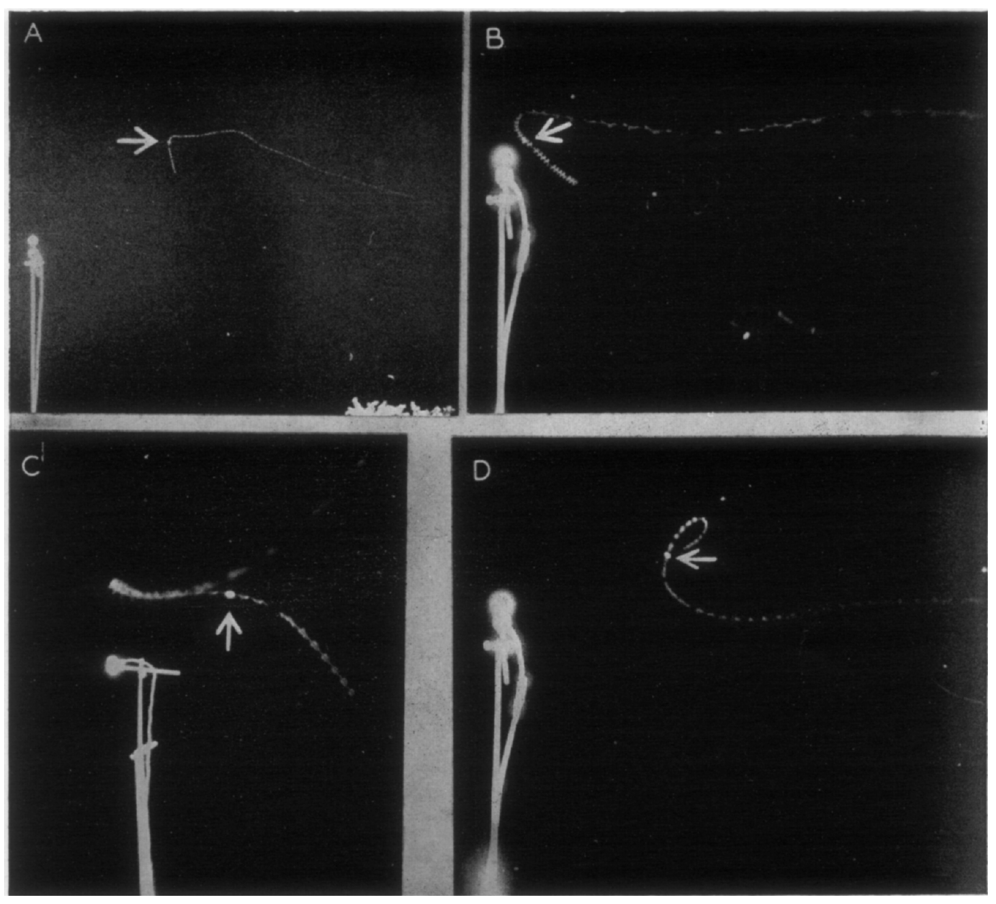
Weaker ultrasound elicits flight away from the source
At greater distances from the source, or after the ultrasonic output was reduced, moths turned and flew away from the loudspeaker. This directional avoidance changed the flight path relative to the source, rather than simply reducing altitude.
The source position was fixed while naturally flying moths crossed the illuminated area. Moths approaching the source could reverse their course; those below it sometimes descended, and those above it could turn upward.
Turning away occurred whether the resulting path carried an insect toward, away from, or across the light gradient. The comparison supports an acoustic contribution to direction. It does not identify the central comparator that converts differences between the two ears into asymmetric wing movements.
Roeder (1962), Fig. 2(A–D). Flight turns away from the sound source.
Roeder (1962)
03
Notes:
• At greater distances from the source, or after the ultrasonic output was reduced, moths turned and flew away from the loudspeaker. This **directional avoidance** changed the flight path relative to the source, rather than simply reducing altitude.
• The source position was fixed while naturally flying moths crossed the illuminated area. Moths approaching the source could reverse their course; those below it sometimes descended, and those above it could turn upward.
– Direction refers to the relationship between the insect’s path and the ultrasonic source. A downward movement can be directional when it carries the moth away from a source above it. A dive alone therefore does not determine whether directional information influenced the response.
• Turning away occurred whether the resulting path carried an insect toward, away from, or across the light gradient. The comparison supports an acoustic contribution to direction. It does not identify the central comparator that converts differences between the two ears into asymmetric wing movements.
References:
Roeder KD (1962). The behaviour of free flying moths in the presence of artificial ultrasonic pulses. Animal Behaviour 10: 300-304. https://doi.org/10.1016/0003-3472(62)90053-2
Figure: Roeder (1962), Fig. 2(A–D). Flight turns away from the sound source.
Figure source: https://doi.org/10.1016/0003-3472(62)90053-2

Slide 4
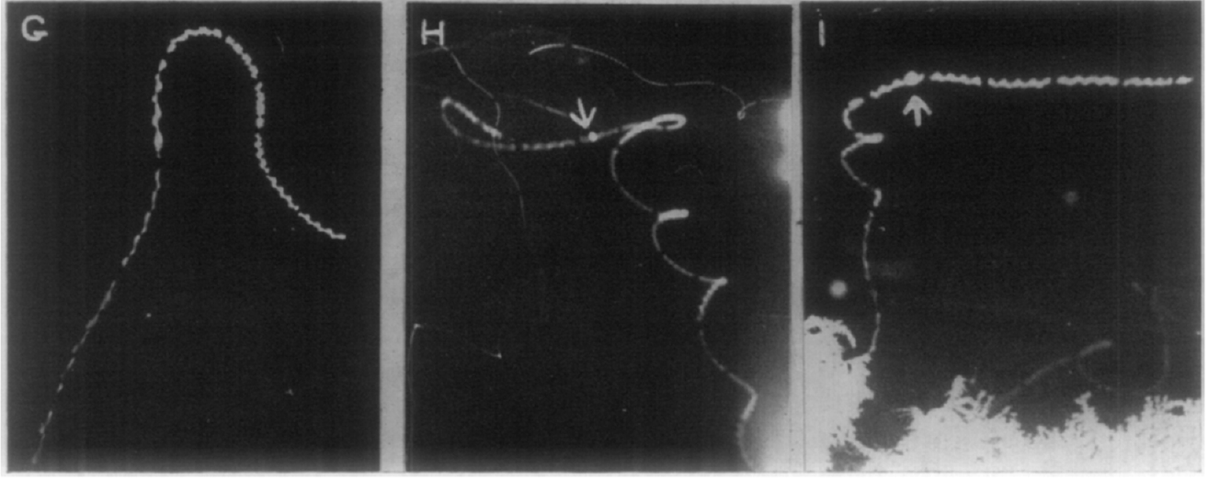
Stronger stimulation recruits varied diving maneuvers
Moths closer to the transducer exhibited a range of escape maneuvers: sharp passive dives, powered dives, loops, tight turns, and climbs followed by descents. Their common tendency was movement toward the ground, rather than a uniform direction away from the source.
Roeder usually repeated ultrasonic pulses 30 times per second. The stimulus continued while flight was photographed, allowing the trajectory after sound onset to be distinguished from the insect’s preceding movement.
Wing movements could cease or increase in frequency after stimulation. The behavioral distinction between weaker-source avoidance and stronger-source diving is supported by these records. A simple assignment of each maneuver to one receptor cell is not established, because the experiment did not selectively manipulate auditory neurons or reliably identify every responding species.
Roeder (1962), Fig. 1(G–I). Climb–dive and turning responses.
Roeder (1962)
04
Notes:
• Moths closer to the transducer exhibited a range of escape maneuvers: sharp passive dives, powered dives, loops, tight turns, and climbs followed by descents. Their common tendency was movement toward the ground, rather than a uniform direction away from the source.
• Roeder usually repeated ultrasonic pulses 30 times per second. The stimulus continued while flight was photographed, allowing the trajectory after sound onset to be distinguished from the insect’s preceding movement.
– The climb preceding a dive and the continuing wingbeats during a turn are different motor solutions to an acoustic threat. Pooling them into one rigid reflex would discard the actual variation recorded in free flight. Bright lighting remains an experimental limitation even for moths without overt attraction to the lamp.
• Wing movements could cease or increase in frequency after stimulation. The behavioral distinction between weaker-source avoidance and stronger-source diving is supported by these records. A simple assignment of each maneuver to one receptor cell is not established, because the experiment did not selectively manipulate auditory neurons or reliably identify every responding species.
References:
Roeder KD (1962). The behaviour of free flying moths in the presence of artificial ultrasonic pulses. Animal Behaviour 10: 300-304. https://doi.org/10.1016/0003-3472(62)90053-2
Figure: Roeder (1962), Fig. 1(G–I). Climb–dive and turning responses.
Figure source: https://doi.org/10.1016/0003-3472(62)90053-2

Slide 5
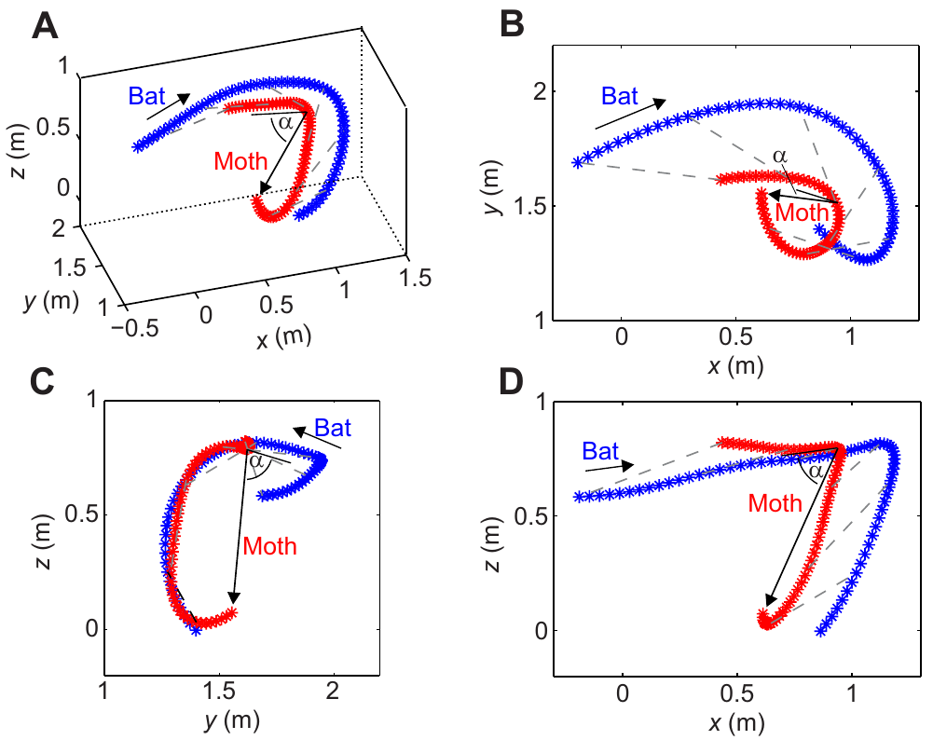
Three-dimensional tracking measures actual bat attacks
Corcoran and Conner recorded long-legged myotis bats, Myotis volans, pursuing naturally flying moths in an outdoor enclosure. Infrared cameras registered predator and prey positions without the visible floodlighting required by Roeder’s photographic method.
The enclosure measured 6 m by 4 m, with a height of 2.2–3 m. Synchronized camera views were calibrated and reconstructed into three-dimensional trajectories, linking movements in space to the outcome of each encounter.
A turn observed from one camera can conceal changes in altitude or depth. Reconstructed trajectories resolve those components and permit measurements of speed and turning performance. The encounters reveal real pursuit and evasion, but the enclosure and available moth assemblage constrain generalization to every hunting habitat and predator species.
Corcoran & Conner (2016), Fig. 3(A–D). Measured three-dimensional evasive flight trajectories.
Corcoran & Conner (2016)
05
Notes:
• Corcoran and Conner recorded long-legged myotis bats, _Myotis volans_, pursuing naturally flying moths in an outdoor enclosure. Infrared cameras registered predator and prey positions without the visible floodlighting required by Roeder’s photographic method.
• The enclosure measured 6 m by 4 m, with a height of 2.2–3 m. Synchronized camera views were calibrated and reconstructed into three-dimensional trajectories, linking movements in space to the outcome of each encounter.
– Calibration assigns a common spatial coordinate system to the camera recordings. The measured paths are therefore trajectories through a volume, rather than drawings inferred from a single photograph. Released moths were allowed to fly naturally before attacks were analyzed.
• A turn observed from one camera can conceal changes in altitude or depth. Reconstructed trajectories resolve those components and permit measurements of speed and turning performance. The encounters reveal real pursuit and evasion, but the enclosure and available moth assemblage constrain generalization to every hunting habitat and predator species.
References:
Corcoran AJ, Conner WE (2016). How moths escape bats: predicting outcomes of predator-prey interactions. Journal of Experimental Biology 219: 2704–2715. https://doi.org/10.1242/jeb.137638
Figure: Corcoran & Conner (2016), Fig. 3(A–D). Measured three-dimensional evasive flight trajectories.
Figure source: https://doi.org/10.1242/jeb.137638

Slide 6
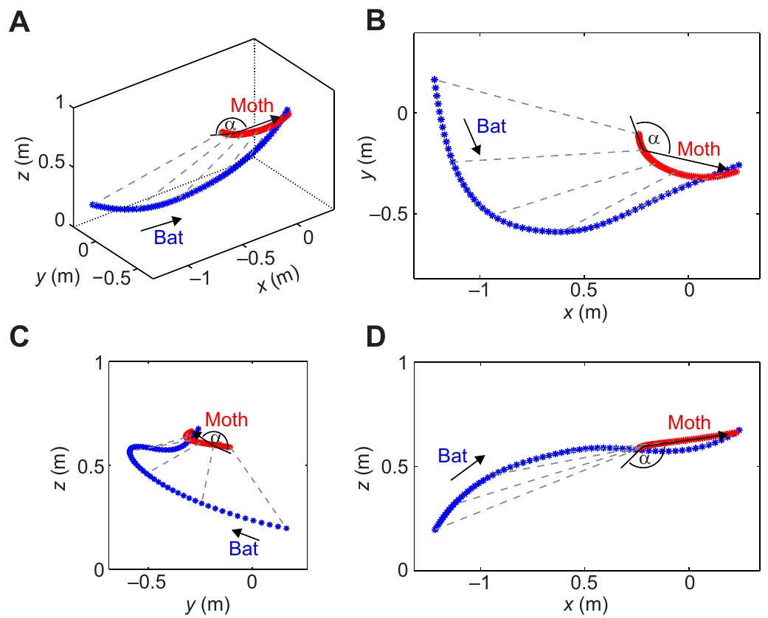
Evasion greatly reduces capture during aerial pursuit
In the observed bat–moth encounters, bats captured 37.5% of evasive prey but 98% of non-evasive prey. Evasion was identified by sharp turns or accelerations during the attack, rather than by labeling every surviving moth as evasive.
Infrared video linked each movement sequence to capture or escape. Non-evasive moths followed comparatively slow or broad paths, whereas evasive moths changed speed or direction abruptly as the bat approached.
The comparison connects flight behavior with survival in this preparation. It does not prove that every difference arose from hearing alone: moth species, body form and flight performance also differed. Successful evasion therefore requires analysis of the actual maneuver as well as the sensory signal that may have initiated it.
Corcoran & Conner (2016), Fig. 4(A–D). Measured capture of a non-evasive moth.
Corcoran & Conner (2016), Fig. 3(A–D). Measured three-dimensional evasive flight trajectories.
Corcoran & Conner (2016)
06
Notes:
• In the observed bat–moth encounters, bats captured 37.5% of evasive prey but 98% of non-evasive prey. Evasion was identified by sharp turns or accelerations during the attack, rather than by labeling every surviving moth as evasive.
• Infrared video linked each movement sequence to capture or escape. Non-evasive moths followed comparatively slow or broad paths, whereas evasive moths changed speed or direction abruptly as the bat approached.
– The distinction between movement and outcome prevents a circular definition of escape behavior. An evasive moth can still be captured, and survival alone does not specify the maneuver. The authors measured kinematics to examine why some evasive paths succeeded while others did not.
• The comparison connects flight behavior with survival in this preparation. It does not prove that every difference arose from hearing alone: moth species, body form and flight performance also differed. Successful evasion therefore requires analysis of the actual maneuver as well as the sensory signal that may have initiated it.
References:
Corcoran AJ, Conner WE (2016). How moths escape bats: predicting outcomes of predator-prey interactions. Journal of Experimental Biology 219: 2704–2715. https://doi.org/10.1242/jeb.137638
Figure: Corcoran & Conner (2016), Fig. 4(A–D). Measured capture of a non-evasive moth.
Figure source: https://doi.org/10.1242/jeb.137638
Figure: Corcoran & Conner (2016), Fig. 3(A–D). Measured three-dimensional evasive flight trajectories.
Figure source: https://doi.org/10.1242/jeb.137638

Slide 7
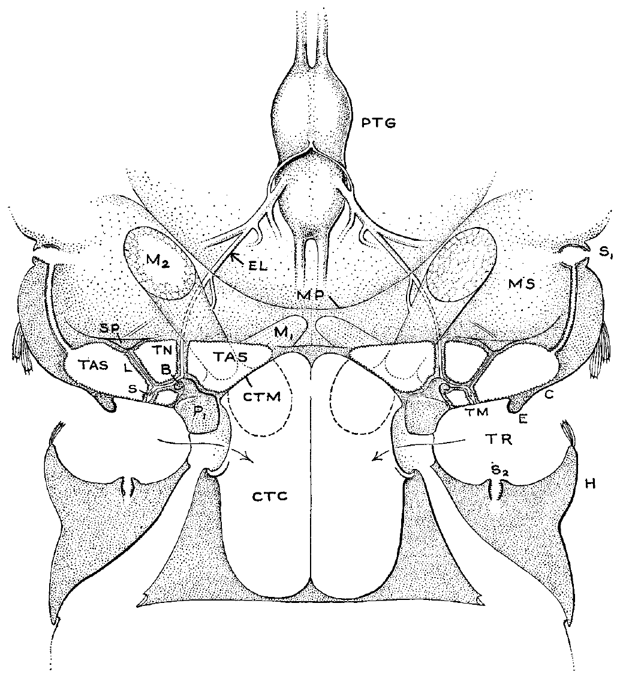
Noctuid ears connect the tympanum to sensory neurons
A tympanum is a thin membrane that vibrates in response to airborne sound. In noctuid moths it occupies a recessed region of the posterior thorax, near the junction between thorax and abdomen.
Roeder and Treat described a sensory attachment on the membrane’s inner surface, enclosed within the tympanic air sac. The tympanic nerve, a bundle carrying sensory axons, runs from this apparatus toward the thoracic ganglion.
This anatomy provides a mechanical route from external sound to sensory tissue and a neural route into the central nervous system. The published anatomical reconstruction identifies named supporting structures, but it is not a measurement of vibration or a complete synaptic map. Its functional interpretation depends on the separate nerve-recording experiments.
Roeder & Treat (1957), Fig. 1. Published noctuid ear, nerve and ganglion anatomy.
Roeder & Treat (1957)
07
Notes:
• A **tympanum** is a thin membrane that vibrates in response to airborne sound. In noctuid moths it occupies a recessed region of the posterior thorax, near the junction between thorax and abdomen.
• Roeder and Treat described a sensory attachment on the membrane’s inner surface, enclosed within the tympanic air sac. The **tympanic nerve**, a bundle carrying sensory axons, runs from this apparatus toward the thoracic ganglion.
– The membrane, sensory attachment and nerve are distinct components. Sound must first move the membrane; the attached receptors must then convert that movement into neural activity. A visible anatomical connection does not by itself specify either the mechanical sensitivity or the neural threshold.
• This anatomy provides a mechanical route from external sound to sensory tissue and a neural route into the central nervous system. The published anatomical reconstruction identifies named supporting structures, but it is not a measurement of vibration or a complete synaptic map. Its functional interpretation depends on the separate nerve-recording experiments.
References:
Roeder KD, Treat AE (1957). Ultrasonic reception by the tympanic organ of noctuid moths. Journal of Experimental Zoology 134: 127-157. https://doi.org/10.1002/jez.1401340107
Figure: Roeder & Treat (1957), Fig. 1. Published noctuid ear, nerve and ganglion anatomy.
Figure source: https://doi.org/10.1002/jez.1401340107

Slide 8
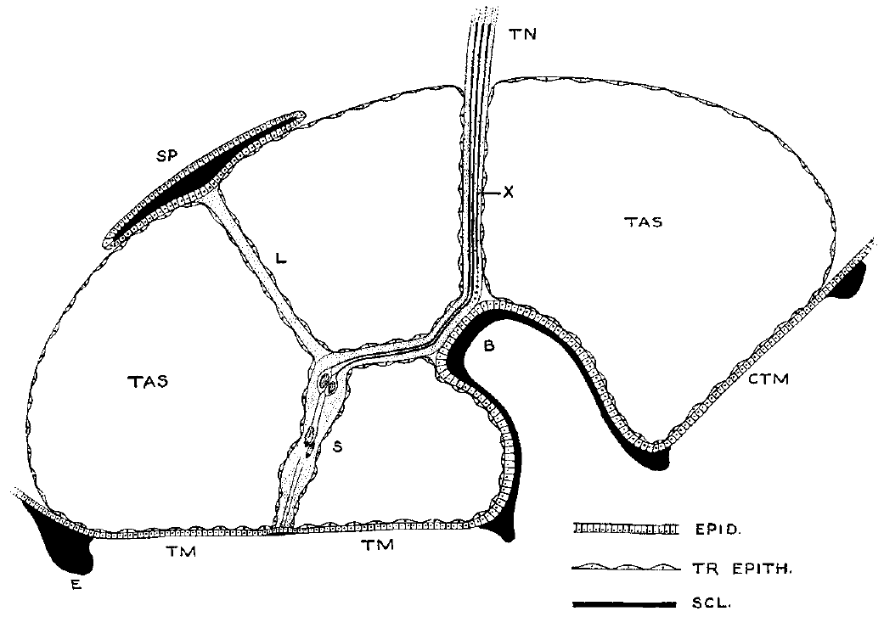
Sensory attachments couple membrane motion to the ear
The noctuid tympanic sensory organ contains two scolopes, specialized supporting elements associated with sensory-cell dendrites. A dendrite is the peripheral region of a sensory neuron that receives the mechanical stimulus, whereas its axon carries the resulting signal centrally.
The sensory attachment extends inward from the tympanic membrane and is supported by a ligament and surrounding tissues. Roeder and Treat’s published section represents these relationships while explicitly leaving some cellular details presumptive.
Two acoustic response units were subsequently distinguished in the nerve recordings. Agreement between anatomy and physiology supports a small receptor population, but the section does not identify a mechanically gated ion channel or prove the exact force experienced by each dendrite. Those molecular and mechanical questions require different measurements.
Roeder & Treat (1957), Fig. 2. Published section through the ear and sensory attachment.
Roeder & Treat (1957)
08
Notes:
• The noctuid tympanic sensory organ contains two **scolopes**, specialized supporting elements associated with sensory-cell dendrites. A dendrite is the peripheral region of a sensory neuron that receives the mechanical stimulus, whereas its axon carries the resulting signal centrally.
• The sensory attachment extends inward from the tympanic membrane and is supported by a ligament and surrounding tissues. Roeder and Treat’s published section represents these relationships while explicitly leaving some cellular details presumptive.
– A scolops belongs to the supporting receptor apparatus rather than serving as a separate central neuron. The authors warned that cap cells, accessory cells and surrounding epithelium complicate the microscopic picture. The reconstruction should therefore be treated as published anatomy with its original qualifications intact.
• Two acoustic response units were subsequently distinguished in the nerve recordings. Agreement between anatomy and physiology supports a small receptor population, but the section does not identify a mechanically gated ion channel or prove the exact force experienced by each dendrite. Those molecular and mechanical questions require different measurements.
References:
Roeder KD, Treat AE (1957). Ultrasonic reception by the tympanic organ of noctuid moths. Journal of Experimental Zoology 134: 127-157. https://doi.org/10.1002/jez.1401340107
Figure: Roeder & Treat (1957), Fig. 2. Published section through the ear and sensory attachment.
Figure source: https://doi.org/10.1002/jez.1401340107

Slide 9
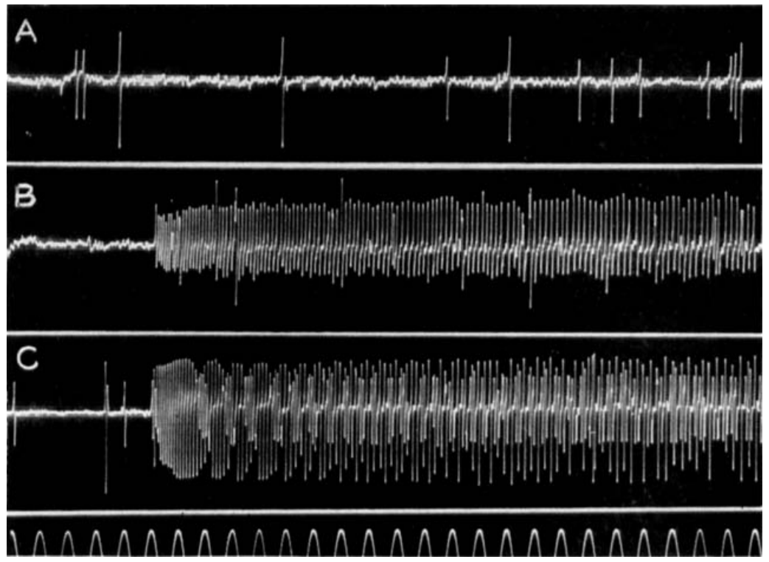
Sound recruits acoustic units within the tympanic nerve
An afferent is a neuron carrying information from a sensory organ toward the central nervous system. Roeder and Treat recorded afferent spikes extracellularly from the tympanic nerve after separating it from central connections.
An extracellular electrode detects voltage changes produced by nearby action potentials, the brief electrical impulses propagated along axons. Sound produced rapid trains in two acoustic units; a larger, regularly recurring non-acoustic unit remained insensitive to the stimulus.
The non-acoustic discharge commonly occurred at 5–20 spikes per second. Separating this activity from sound-evoked spikes prevents every nerve event from being counted as hearing. Different acoustic thresholds distinguish receptor units even when their recorded spike sizes overlap; recording amplitude alone is an unreliable cell label.
Roeder & Treat (1957), Fig. 3(A–C). Spontaneous and sound-evoked nerve activity.
Roeder & Treat (1957), Fig. 2. Published section through the ear and sensory attachment.
Roeder & Treat (1957)
09
Notes:
• An **afferent** is a neuron carrying information from a sensory organ toward the central nervous system. Roeder and Treat recorded afferent spikes extracellularly from the tympanic nerve after separating it from central connections.
• An extracellular electrode detects voltage changes produced by nearby action potentials, the brief electrical impulses propagated along axons. Sound produced rapid trains in two acoustic units; a larger, regularly recurring non-acoustic unit remained insensitive to the stimulus.
– The electrical signal is measured outside the axon, so its size depends partly on electrode geometry. The nerve was disconnected from the central ganglion in the original preparation. Sound-evoked activity therefore originated peripherally rather than requiring a feedback command from the brain.
• The non-acoustic discharge commonly occurred at 5–20 spikes per second. Separating this activity from sound-evoked spikes prevents every nerve event from being counted as hearing. Different acoustic thresholds distinguish receptor units even when their recorded spike sizes overlap; recording amplitude alone is an unreliable cell label.
References:
Roeder KD, Treat AE (1957). Ultrasonic reception by the tympanic organ of noctuid moths. Journal of Experimental Zoology 134: 127-157. https://doi.org/10.1002/jez.1401340107
Figure: Roeder & Treat (1957), Fig. 3(A–C). Spontaneous and sound-evoked nerve activity.
Figure source: https://doi.org/10.1002/jez.1401340107
Figure: Roeder & Treat (1957), Fig. 2. Published section through the ear and sensory attachment.
Figure source: https://doi.org/10.1002/jez.1401340107

Slide 10
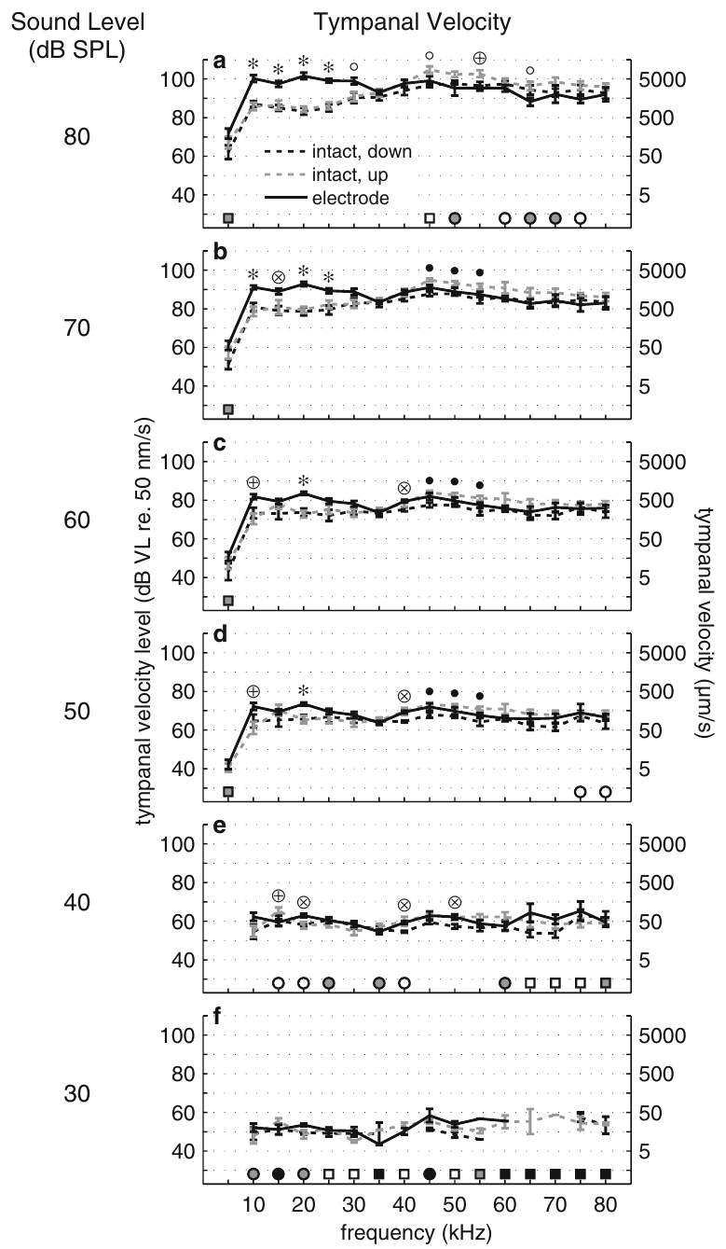
Vibrometry links membrane motion to neural activity
Laser Doppler vibrometry measures surface motion from changes in reflected laser light. In Noctua pronuba, ter Hofstede and colleagues directed the laser at the tympanum’s sensory-cell attachment while presenting calibrated sound pulses.
The method recorded velocity, the speed of membrane motion, and displacement, its excursion from the resting position. Stimuli lasted 20 ms and sampled frequencies from 5 to 80 kHz; incident sound was measured beside the ear.
Simultaneous auditory-nerve recordings linked mechanical responses to spike production. Measuring the same attachment rather than an arbitrary membrane location constrains the relevant receptor input. These observations describe the physical stimulus to the sensory cells, but they do not identify the molecular channel that first converts force into membrane current.
Roeder & Treat (1957), Fig. 2. Published section through the ear and sensory attachment.
ter Hofstede et al. (2011), Fig. 1(a–f). Membrane velocity in intact and dissected preparations.
ter Hofstede et al. (2011); Roeder & Treat (1957)
10
Notes:
• **Laser Doppler vibrometry** measures surface motion from changes in reflected laser light. In _Noctua pronuba_, ter Hofstede and colleagues directed the laser at the tympanum’s sensory-cell attachment while presenting calibrated sound pulses.
• The method recorded velocity, the speed of membrane motion, and displacement, its excursion from the resting position. Stimuli lasted 20 ms and sampled frequencies from 5 to 80 kHz; incident sound was measured beside the ear.
– The speaker was 30 cm from the preparation, while the microphone was placed approximately 2 mm beside the ear. Local measurement matters because the animal and recording equipment can change the sound field. The sensory attachment is the mechanical location relevant to the receptor, rather than simply the point that is easiest to illuminate.
• Simultaneous auditory-nerve recordings linked mechanical responses to spike production. Measuring the same attachment rather than an arbitrary membrane location constrains the relevant receptor input. These observations describe the physical stimulus to the sensory cells, but they do not identify the molecular channel that first converts force into membrane current.
References:
ter Hofstede HM, Goerlitz HR, Montealegre-Z F, Robert D, Holderied MW (2011). Tympanal mechanics and neural responses in the ears of a noctuid moth. Naturwissenschaften 98: 1057-1061. https://doi.org/10.1007/s00114-011-0851-7
Roeder KD, Treat AE (1957). Ultrasonic reception by the tympanic organ of noctuid moths. Journal of Experimental Zoology 134: 127-157. https://doi.org/10.1002/jez.1401340107
Figure: ter Hofstede et al. (2011), Fig. 1(a–f). Membrane velocity in intact and dissected preparations.
Figure source: https://doi.org/10.1007/s00114-011-0851-7
Figure: Roeder & Treat (1957), Fig. 2. Published section through the ear and sensory attachment.
Figure source: https://doi.org/10.1002/jez.1401340107

Slide 11
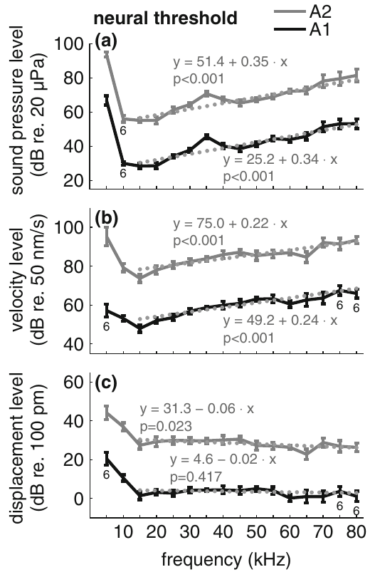
Displacement predicts the threshold for auditory spikes
A neural threshold is the lowest stimulus satisfying a stated response criterion. Across 15–80 kHz, the tympanic displacement at threshold remained approximately constant, whereas the corresponding membrane velocity increased with frequency.
The mean threshold displacement was 140 pm for A1 and 2510 pm for A2. A picometre is one trillionth of a metre. A1 and A2 denote the more sensitive and less sensitive acoustic receptor cells, respectively.
Sound-pressure thresholds alone combine the ear’s mechanical response with the receptor’s sensitivity. The stable displacement thresholds support displacement as the relevant mechanical input under these pure-tone conditions. They do not prove the identity or gating properties of a transduction channel, and the relationship differs at the lowest tested frequencies.
Roeder & Treat (1957), Fig. 2. Published section through the ear and sensory attachment.
ter Hofstede et al. (2011), Fig. 2(a–c). Pressure, velocity and displacement at neural threshold.
ter Hofstede et al. (2011); Roeder & Treat (1957)
11
Notes:
• A **neural threshold** is the lowest stimulus satisfying a stated response criterion. Across 15–80 kHz, the tympanic displacement at threshold remained approximately constant, whereas the corresponding membrane velocity increased with frequency.
• The mean threshold displacement was 140 pm for A1 and 2510 pm for A2. A picometre is one trillionth of a metre. A1 and A2 denote the more sensitive and less sensitive acoustic receptor cells, respectively.
– A higher-frequency oscillation can move faster while covering the same displacement. The relevant comparison is therefore the membrane motion required for the same neural response, not simply whether a loud sound produces a large vibration. A2 required considerably greater movement than A1.
• Sound-pressure thresholds alone combine the ear’s mechanical response with the receptor’s sensitivity. The stable displacement thresholds support displacement as the relevant mechanical input under these pure-tone conditions. They do not prove the identity or gating properties of a transduction channel, and the relationship differs at the lowest tested frequencies.
References:
ter Hofstede HM, Goerlitz HR, Montealegre-Z F, Robert D, Holderied MW (2011). Tympanal mechanics and neural responses in the ears of a noctuid moth. Naturwissenschaften 98: 1057-1061. https://doi.org/10.1007/s00114-011-0851-7
Roeder KD, Treat AE (1957). Ultrasonic reception by the tympanic organ of noctuid moths. Journal of Experimental Zoology 134: 127-157. https://doi.org/10.1002/jez.1401340107
Figure: ter Hofstede et al. (2011), Fig. 2(a–c). Pressure, velocity and displacement at neural threshold.
Figure source: https://doi.org/10.1007/s00114-011-0851-7
Figure: Roeder & Treat (1957), Fig. 2. Published section through the ear and sensory attachment.
Figure source: https://doi.org/10.1002/jez.1401340107

Slide 12
Dissection preserves near-threshold membrane motion
Exposing the auditory nerve could alter the ear’s biomechanics. Ter Hofstede and colleagues therefore compared the same moth in intact flight orientation, intact inverted orientation, and an inverted preparation with the nerve-recording electrodes inserted.
Near neural threshold, tympanic velocity and displacement showed no consistent difference across those treatments. Sound levels were defined as dB SPL, a logarithmic sound-pressure measure referenced to 20 µPa.
At stronger stimulation, particularly below 35 kHz, dissected preparations could show greater membrane movement than intact animals. The control supports near-threshold recordings as estimates of intact hearing under the tested conditions. It does not validate every suprathreshold response or every frequency-modulated bat call, because those conditions were not equivalently tested.
Roeder & Treat (1957), Fig. 2. Published section through the ear and sensory attachment.
ter Hofstede et al. (2011), Fig. 1(a–f). Membrane velocity in intact and dissected preparations.
ter Hofstede et al. (2011); Roeder & Treat (1957)
12
Notes:
• Exposing the auditory nerve could alter the ear’s biomechanics. Ter Hofstede and colleagues therefore compared the same moth in intact flight orientation, intact inverted orientation, and an inverted preparation with the nerve-recording electrodes inserted.
• Near neural threshold, tympanic velocity and displacement showed no consistent difference across those treatments. Sound levels were defined as **dB SPL**, a logarithmic sound-pressure measure referenced to 20 µPa.
– The order of the two intact orientations alternated between animals to reduce an order effect. Removing muscles and inserting an electrode may have little consistent influence near threshold while still changing behavior at stronger sound levels. Validation applies to the measured range rather than to the preparation without limits.
• At stronger stimulation, particularly below 35 kHz, dissected preparations could show greater membrane movement than intact animals. The control supports near-threshold recordings as estimates of intact hearing under the tested conditions. It does not validate every suprathreshold response or every frequency-modulated bat call, because those conditions were not equivalently tested.
References:
ter Hofstede HM, Goerlitz HR, Montealegre-Z F, Robert D, Holderied MW (2011). Tympanal mechanics and neural responses in the ears of a noctuid moth. Naturwissenschaften 98: 1057-1061. https://doi.org/10.1007/s00114-011-0851-7
Roeder KD, Treat AE (1957). Ultrasonic reception by the tympanic organ of noctuid moths. Journal of Experimental Zoology 134: 127-157. https://doi.org/10.1002/jez.1401340107
Figure: ter Hofstede et al. (2011), Fig. 1(a–f). Membrane velocity in intact and dissected preparations.
Figure source: https://doi.org/10.1007/s00114-011-0851-7
Figure: Roeder & Treat (1957), Fig. 2. Published section through the ear and sensory attachment.
Figure source: https://doi.org/10.1002/jez.1401340107

Slide 13
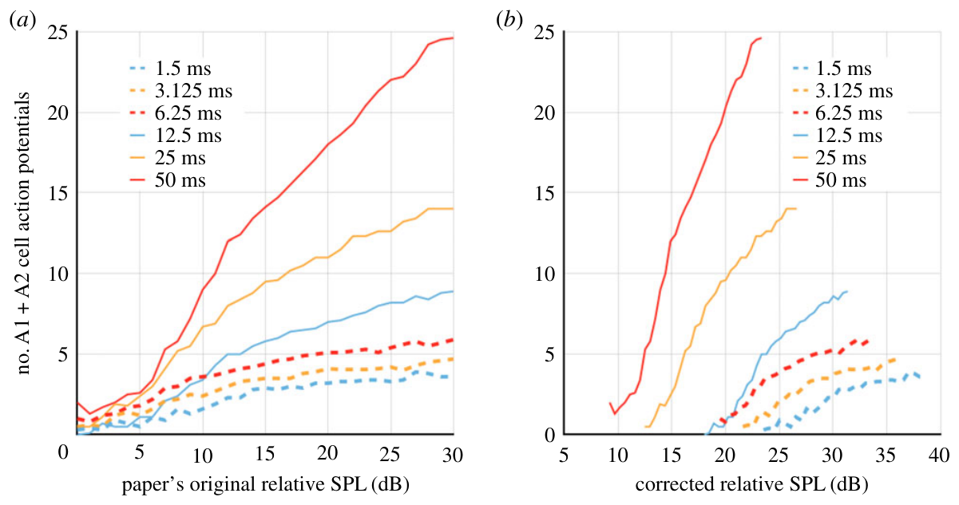
Sound-level meters can bias pulse-duration comparisons
A conventional sound-level meter can average brief pulses through its time-weighting circuit. For the published 1.5–50-ms pulses, holding the displayed reading constant can require different true pulse amplitudes when duration changes.
Thevenon and Pfuhl reanalyzed published moth recordings using a mathematical account of meter damping. Their article compares original duration-dependent spike curves with curves after the assumed measurement bias was corrected.
Corrected pressures change the apparent relation between duration and spike count. This retrospective reanalysis supplies no new moth recordings. Missing meter settings prevent complete reconstruction of the stimuli, so its correction depends on assumptions rather than direct historical calibration.
Thevenon & Pfuhl (2018), Fig. 6(a–b). Published reanalysis before and after meter correction.
Thevenon & Pfuhl (2018)
13
Notes:
• A conventional sound-level meter can average brief pulses through its time-weighting circuit. For the published 1.5–50-ms pulses, holding the displayed reading constant can require different true pulse amplitudes when duration changes.
• Thevenon and Pfuhl reanalyzed published moth recordings using a mathematical account of meter damping. Their article compares original duration-dependent spike curves with curves after the assumed measurement bias was corrected.
– A pulse with a shorter duty cycle can produce a lower averaged meter reading even when its peak pressure is unchanged. Correcting the measurement does not change the recorded spikes; it changes the pressure assigned to the stimulus that elicited them.
• Corrected pressures change the apparent relation between duration and spike count. This retrospective reanalysis supplies no new moth recordings. Missing meter settings prevent complete reconstruction of the stimuli, so its correction depends on assumptions rather than direct historical calibration.
References:
Thevenon H, Pfuhl G (2018). Discrepancies in the spiking threshold and frequency sensitivity of nocturnal moths explainable by biases in the canonical auditory stimulation method. Royal Society Open Science 5: 172404. https://doi.org/10.1098/rsos.172404
Figure: Thevenon & Pfuhl (2018), Fig. 6(a–b). Published reanalysis before and after meter correction.
Figure source: https://doi.org/10.1098/rsos.172404

Slide 14
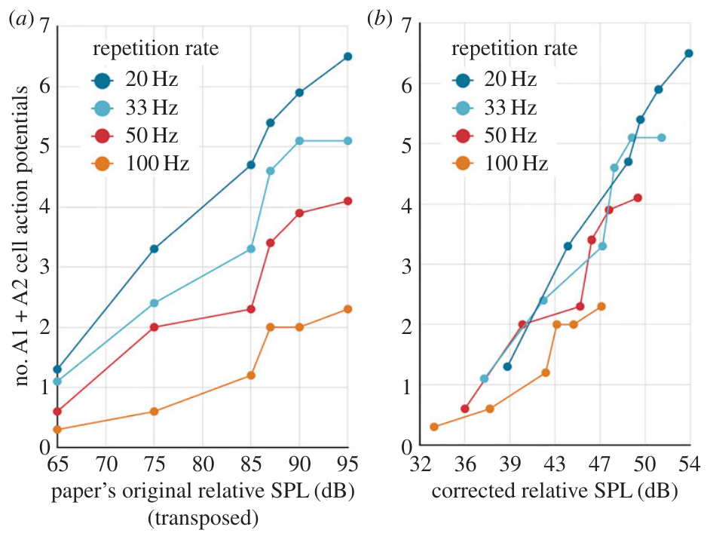
Repetition-rate effects depend on amplitude calibration
Thevenon and Pfuhl also examined published spike responses to pulses repeated at 20, 33, 50 or 100 Hz. More frequent pulses occupy more of the meter’s averaging interval, so a matched displayed level need not mean matched instantaneous sound pressure.
Their published correction aligned much of the repetition-rate dependence in the reanalyzed dataset. The result raises a calibration-based alternative to interpreting every reduction in spikes per pulse as neural adaptation.
The analysis depends on the modeled damping circuit and information reported in the original methods. It does not establish that adaptation is absent in all moths or all stimulus sequences. A stronger test measures the local sound waveform directly and compares responses under a clearly defined amplitude convention.
Thevenon & Pfuhl (2018), Fig. 7(a–b). Published repetition-rate data reanalysis.
Thevenon & Pfuhl (2018)
14
Notes:
• Thevenon and Pfuhl also examined published spike responses to pulses repeated at 20, 33, 50 or 100 Hz. More frequent pulses occupy more of the meter’s averaging interval, so a matched displayed level need not mean matched instantaneous sound pressure.
• Their published correction aligned much of the repetition-rate dependence in the reanalyzed dataset. The result raises a calibration-based alternative to interpreting every reduction in spikes per pulse as neural adaptation.
– Pulse rate and pulse duration both influence the time occupied by sound. The source paper could not retrospectively correct all records because equipment details were missing. Its corrected plots are evidence about possible measurement bias rather than a replacement for the original neural recordings.
• The analysis depends on the modeled damping circuit and information reported in the original methods. It does not establish that adaptation is absent in all moths or all stimulus sequences. A stronger test measures the local sound waveform directly and compares responses under a clearly defined amplitude convention.
References:
Thevenon H, Pfuhl G (2018). Discrepancies in the spiking threshold and frequency sensitivity of nocturnal moths explainable by biases in the canonical auditory stimulation method. Royal Society Open Science 5: 172404. https://doi.org/10.1098/rsos.172404
Figure: Thevenon & Pfuhl (2018), Fig. 7(a–b). Published repetition-rate data reanalysis.
Figure source: https://doi.org/10.1098/rsos.172404

Slide 15
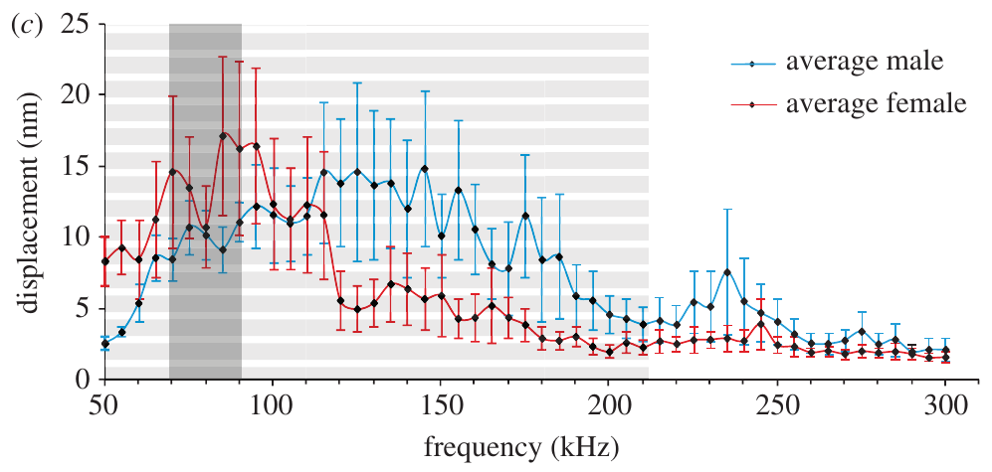
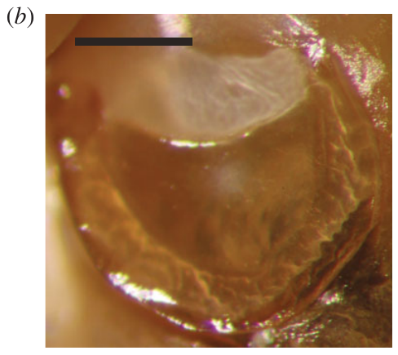
Wax-moth membranes respond across a broad bandwidth
The greater wax moth, Galleria mellonella, has four auditory receptor cells per ear, contrasting with the two-cell noctuid system. Moir and colleagues measured membrane movement optically to determine how broadly its tympanum responds to ultrasound.
At 90 dB SPL, membrane oscillations exceeded 1 nm throughout the tested 50–300-kHz range. A nanometre is one billionth of a metre. Maximum movement occurred at the sensory attachment, rather than uniformly across the membrane.
A mechanically responsive tympanum does not establish neural hearing at every tested frequency. The membrane must move enough to activate its receptors, and neural responses were measured separately. The broad mechanical bandwidth is an observed property; its proposed advantage for rapid temporal responses remains an interpretation requiring behavioral tests.
Moir et al. (2013), Fig. 1(c). Membrane displacement at 90 dB SPL.
Moir et al. (2013), Fig. 1(b). Greater wax-moth tympanum; scale bar 0.1 mm.
Moir et al. (2013)
15
Notes:
• The greater wax moth, _Galleria mellonella_, has four auditory receptor cells per ear, contrasting with the two-cell noctuid system. Moir and colleagues measured membrane movement optically to determine how broadly its tympanum responds to ultrasound.
• At 90 dB SPL, membrane oscillations exceeded 1 nm throughout the tested 50–300-kHz range. A nanometre is one billionth of a metre. Maximum movement occurred at the sensory attachment, rather than uniformly across the membrane.
– The female displacement maximum occurred around 90–95 kHz, within the reported male calling range. The paper did not establish a reliable sex difference in mechanical tuning. Mechanical sensitivity and neural sensitivity must remain distinct because each describes a different stage of the ear’s response.
• A mechanically responsive tympanum does not establish neural hearing at every tested frequency. The membrane must move enough to activate its receptors, and neural responses were measured separately. The broad mechanical bandwidth is an observed property; its proposed advantage for rapid temporal responses remains an interpretation requiring behavioral tests.
References:
Moir HM, Jackson JC, Windmill JFC (2013). Extremely high frequency sensitivity in a ‘simple’ ear. Biology Letters 9: 20130241. https://doi.org/10.1098/rsbl.2013.0241
Figure: Moir et al. (2013), Fig. 1(c). Membrane displacement at 90 dB SPL.
Figure source: https://doi.org/10.1098/rsbl.2013.0241
Figure: Moir et al. (2013), Fig. 1(b). Greater wax-moth tympanum; scale bar 0.1 mm.
Figure source: https://doi.org/10.1098/rsbl.2013.0241

Slide 16
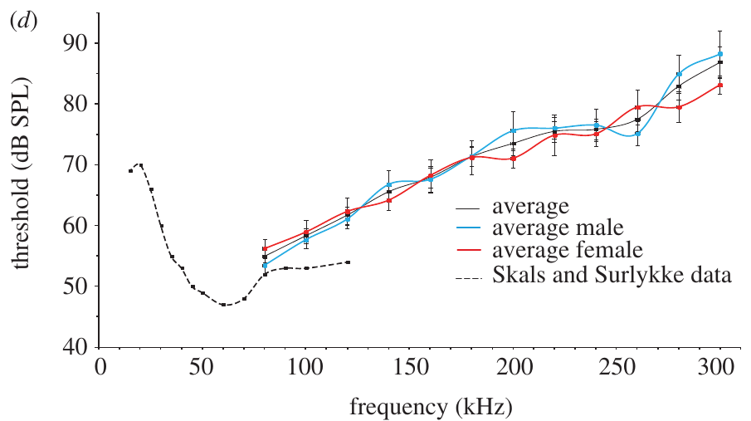
Wax-moth receptors respond at frequencies up to 300 kHz
Moir and colleagues recorded the wax moth’s auditory nerve during 20-ms pure-tone pulses. A response criterion requiring repeated sound-associated spikes reduced the chance of mistaking spontaneous firing for an auditory response.
The lowest measured threshold was approximately 55 dB SPL at 80 kHz. In responding animals, thresholds rose to approximately 83 dB SPL at 280 kHz and 87 dB SPL at 300 kHz; some animals did not respond at the maximum tested 90 dB SPL.
These recordings establish neural sensitivity to exceptionally high frequencies in this preparation. They do not establish effective flight avoidance at 300 kHz or a natural bat threat using that frequency. The ecological purpose of the extended sensitivity was unresolved in the study.
Moir et al. (2013), Fig. 1(d). Neural thresholds across frequency.
Moir et al. (2013), Fig. 1(b). Greater wax-moth tympanum; scale bar 0.1 mm.
Moir et al. (2013)
16
Notes:
• Moir and colleagues recorded the wax moth’s auditory nerve during 20-ms pure-tone pulses. A response criterion requiring repeated sound-associated spikes reduced the chance of mistaking spontaneous firing for an auditory response.
• The lowest measured threshold was approximately 55 dB SPL at 80 kHz. In responding animals, thresholds rose to approximately 83 dB SPL at 280 kHz and 87 dB SPL at 300 kHz; some animals did not respond at the maximum tested 90 dB SPL.
– The threshold curve reports sensitivity, not the loudness of a call normally encountered outdoors. Higher thresholds mean that stronger sound is required to evoke spikes. The authors explicitly called for behavioral studies to test whether the extreme frequencies lead to defensive responses.
• These recordings establish neural sensitivity to exceptionally high frequencies in this preparation. They do not establish effective flight avoidance at 300 kHz or a natural bat threat using that frequency. The ecological purpose of the extended sensitivity was unresolved in the study.
References:
Moir HM, Jackson JC, Windmill JFC (2013). Extremely high frequency sensitivity in a ‘simple’ ear. Biology Letters 9: 20130241. https://doi.org/10.1098/rsbl.2013.0241
Figure: Moir et al. (2013), Fig. 1(d). Neural thresholds across frequency.
Figure source: https://doi.org/10.1098/rsbl.2013.0241
Figure: Moir et al. (2013), Fig. 1(b). Greater wax-moth tympanum; scale bar 0.1 mm.
Figure source: https://doi.org/10.1098/rsbl.2013.0241

Slide 17
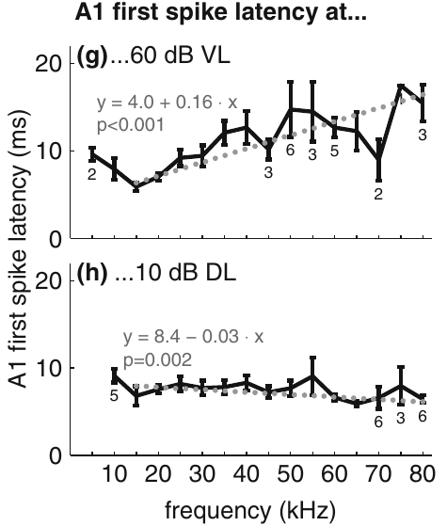
Constant displacement stabilizes A1 response latency
First-spike latency is the delay between stimulus arrival and the first auditory action potential. Ter Hofstede and colleagues measured A1 latency while holding either membrane velocity or displacement constant across frequencies.
At constant displacement, the first spike remained near 7 ms over most of the tested range. At constant velocity, latency increased with frequency. The relationship was consistent with the displacement-based thresholds obtained independently.
Displacement constrains receptor excitation more closely than velocity under these conditions. The experiment links the mechanical input to the timing of neuronal output, rather than only to the presence of spikes. The extracellular record still does not separate the receptor’s generator potential from the subsequent ionic mechanisms producing an action potential.
Roeder & Treat (1957), Fig. 2. Published section through the ear and sensory attachment.
ter Hofstede et al. (2011), Fig. 2(g–h). A1 latency at constant velocity or displacement.
ter Hofstede et al. (2011); Roeder & Treat (1957)
17
Notes:
• **First-spike latency** is the delay between stimulus arrival and the first auditory action potential. Ter Hofstede and colleagues measured A1 latency while holding either membrane velocity or displacement constant across frequencies.
• At constant displacement, the first spike remained near 7 ms over most of the tested range. At constant velocity, latency increased with frequency. The relationship was consistent with the displacement-based thresholds obtained independently.
– A generator potential is the local graded electrical response that precedes spike production. The study recorded the resulting spikes and membrane movement, rather than directly measuring that potential. Constant displacement preserving timing is a second test of the mechanical-input hypothesis.
• Displacement constrains receptor excitation more closely than velocity under these conditions. The experiment links the mechanical input to the timing of neuronal output, rather than only to the presence of spikes. The extracellular record still does not separate the receptor’s generator potential from the subsequent ionic mechanisms producing an action potential.
References:
ter Hofstede HM, Goerlitz HR, Montealegre-Z F, Robert D, Holderied MW (2011). Tympanal mechanics and neural responses in the ears of a noctuid moth. Naturwissenschaften 98: 1057-1061. https://doi.org/10.1007/s00114-011-0851-7
Roeder KD, Treat AE (1957). Ultrasonic reception by the tympanic organ of noctuid moths. Journal of Experimental Zoology 134: 127-157. https://doi.org/10.1002/jez.1401340107
Figure: ter Hofstede et al. (2011), Fig. 2(g–h). A1 latency at constant velocity or displacement.
Figure source: https://doi.org/10.1007/s00114-011-0851-7
Figure: Roeder & Treat (1957), Fig. 2. Published section through the ear and sensory attachment.
Figure source: https://doi.org/10.1002/jez.1401340107

Slide 18
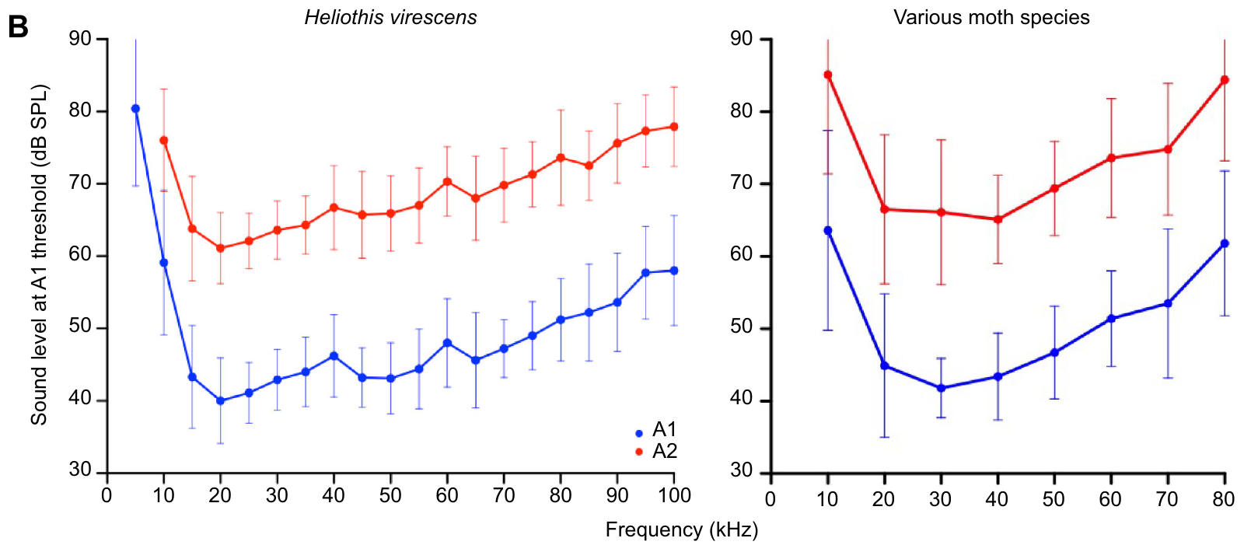
A1 and A2 sample different sound-level ranges
Gordon and ter Hofstede compared acoustic thresholds in noctuid and erebid moths using extracellular auditory-nerve recordings. An audiogram is the relationship between stimulus frequency and the level needed to evoke a specified response.
The moths were most sensitive between 15 and 55 kHz. A2 thresholds generally exceeded A1 thresholds by 15–20 dB. At 5–10 kHz, substantially stronger sound was needed, and thresholds also increased at higher ultrasonic frequencies.
The two cells expand the range of sound levels that can influence the nerve signal. Threshold separation does not assign a distinct behavior to either neuron. It also does not imply that the animal discriminates pitch, because frequency-dependent sensitivity can exist without an output that uniquely identifies sound frequency.
Gordon & ter Hofstede (2018), Fig. 1(B). A1 and A2 frequency thresholds.
Roeder & Treat (1957), Fig. 2. Published section through the ear and sensory attachment.
Gordon & ter Hofstede (2018); Roeder & Treat (1957)
18
Notes:
• Gordon and ter Hofstede compared acoustic thresholds in noctuid and erebid moths using extracellular auditory-nerve recordings. An **audiogram** is the relationship between stimulus frequency and the level needed to evoke a specified response.
• The moths were most sensitive between 15 and 55 kHz. A2 thresholds generally exceeded A1 thresholds by 15–20 dB. At 5–10 kHz, substantially stronger sound was needed, and thresholds also increased at higher ultrasonic frequencies.
– The recording and comparison distinguish the more sensitive A1 cell from A2 using threshold, timing and spike form together. The curves concern sound at the ear, referenced to a stated calibration. They are not direct measurements of a bat’s distance or of a freely flying moth’s escape decision.
• The two cells expand the range of sound levels that can influence the nerve signal. Threshold separation does not assign a distinct behavior to either neuron. It also does not imply that the animal discriminates pitch, because frequency-dependent sensitivity can exist without an output that uniquely identifies sound frequency.
References:
Gordon SD, ter Hofstede HM (2018). The influence of bat echolocation call duration and timing on auditory encoding of predator distance in noctuoid moths. Journal of Experimental Biology 221: jeb171561. https://doi.org/10.1242/jeb.171561
Roeder KD, Treat AE (1957). Ultrasonic reception by the tympanic organ of noctuid moths. Journal of Experimental Zoology 134: 127-157. https://doi.org/10.1002/jez.1401340107
Figure: Gordon & ter Hofstede (2018), Fig. 1(B). A1 and A2 frequency thresholds.
Figure source: https://doi.org/10.1242/jeb.171561
Figure: Roeder & Treat (1957), Fig. 2. Published section through the ear and sensory attachment.
Figure source: https://doi.org/10.1002/jez.1401340107

Slide 19
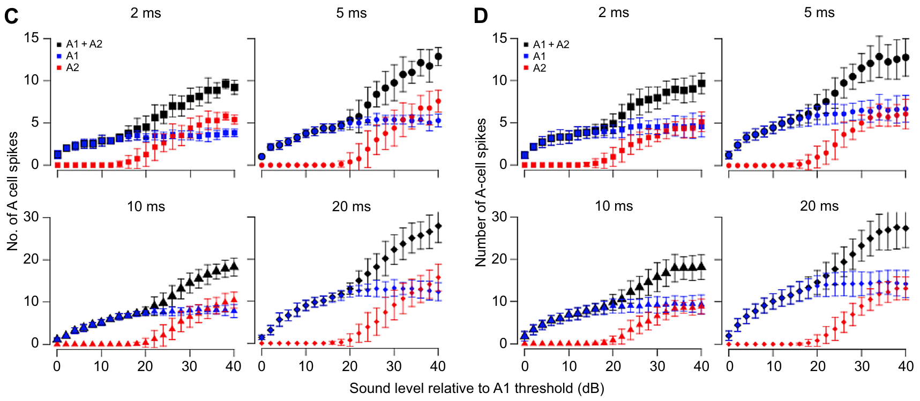
A2 extends coding after A1 activity begins to saturate
Range fractionation divides a sensory intensity range among receptors with different thresholds. In moths, A1 begins responding at lower levels and A2 is recruited when the sound is stronger.
Gordon and ter Hofstede measured separate A1 and A2 spike counts for 50-kHz pulses lasting 2, 5, 10 or 20 ms. Longer pulses often permitted A1 output to increase toward the level at which A2 began firing.
For short pulses, A1 could reach a plateau before A2 was recruited, leaving a gap in count-based intensity coding. A2 therefore extends the ear’s coding range but does not guarantee uninterrupted information at every duration. The same sound level can yield different spike counts when pulse duration changes.
Gordon & ter Hofstede (2018), Fig. 2(C–D). Separate A1 and A2 intensity responses by duration.
Roeder & Treat (1957), Fig. 2. Published section through the ear and sensory attachment.
Gordon & ter Hofstede (2018); Roeder & Treat (1957)
19
Notes:
• **Range fractionation** divides a sensory intensity range among receptors with different thresholds. In moths, A1 begins responding at lower levels and A2 is recruited when the sound is stronger.
• Gordon and ter Hofstede measured separate A1 and A2 spike counts for 50-kHz pulses lasting 2, 5, 10 or 20 ms. Longer pulses often permitted A1 output to increase toward the level at which A2 began firing.
– Saturation means that raising the input no longer increases the selected output measure. Here the selected measure is spikes per sound pulse. The output of the two cells must be examined separately because their sum can conceal a plateau in A1 before A2 begins to contribute.
• For short pulses, A1 could reach a plateau before A2 was recruited, leaving a gap in count-based intensity coding. A2 therefore extends the ear’s coding range but does not guarantee uninterrupted information at every duration. The same sound level can yield different spike counts when pulse duration changes.
References:
Gordon SD, ter Hofstede HM (2018). The influence of bat echolocation call duration and timing on auditory encoding of predator distance in noctuoid moths. Journal of Experimental Biology 221: jeb171561. https://doi.org/10.1242/jeb.171561
Roeder KD, Treat AE (1957). Ultrasonic reception by the tympanic organ of noctuid moths. Journal of Experimental Zoology 134: 127-157. https://doi.org/10.1002/jez.1401340107
Figure: Gordon & ter Hofstede (2018), Fig. 2(C–D). Separate A1 and A2 intensity responses by duration.
Figure source: https://doi.org/10.1242/jeb.171561
Figure: Roeder & Treat (1957), Fig. 2. Published section through the ear and sensory attachment.
Figure source: https://doi.org/10.1002/jez.1401340107

Slide 20
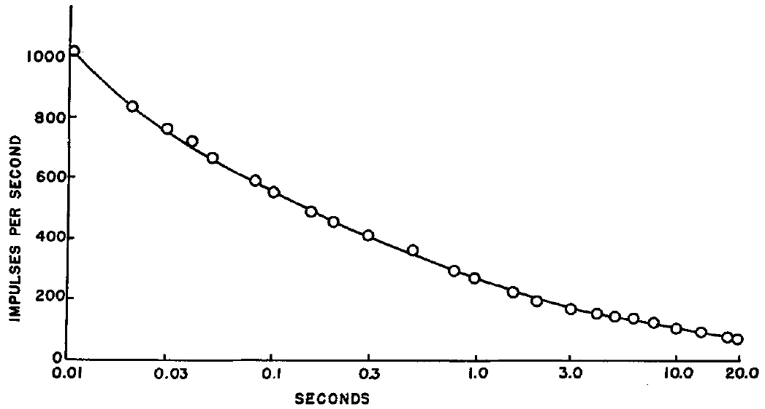
A sustained tone rapidly adapts the acoustic response
Adaptation is a reduction in sensory response during continuing or repeated stimulation. Roeder and Treat followed the more sensitive acoustic unit during a sustained 70-kHz tone and counted its spikes over time.
In that recording, the initial rate approached 1000 spikes per second, fell to about half that rate within 0.1 s, and reached roughly one quarter by 1 s. A slower decline continued toward an irregular discharge near 90 spikes per second.
The result establishes a time-dependent change in the peripheral output despite continuing sound. It does not identify whether the change originates in receptor mechanics, transduction or spike-generating conductances. Because sound pressure was not measured in this particular experiment, the curve cannot be assigned a precise absolute intensity.
Roeder & Treat (1957), Fig. 6. Spike-rate adaptation to a 70-kHz tone.
Roeder & Treat (1957), Fig. 2. Published section through the ear and sensory attachment.
Roeder & Treat (1957)
20
Notes:
• **Adaptation** is a reduction in sensory response during continuing or repeated stimulation. Roeder and Treat followed the more sensitive acoustic unit during a sustained 70-kHz tone and counted its spikes over time.
• In that recording, the initial rate approached 1000 spikes per second, fell to about half that rate within 0.1 s, and reached roughly one quarter by 1 s. A slower decline continued toward an irregular discharge near 90 spikes per second.
– The initial and later rates belong to the same recorded response, rather than to different receptor populations. Overlapping spikes often prevented reliable counts at high intensity; this recording was selected because the sensitive unit could be distinguished. The mechanism of the rate decline remained unresolved.
• The result establishes a time-dependent change in the peripheral output despite continuing sound. It does not identify whether the change originates in receptor mechanics, transduction or spike-generating conductances. Because sound pressure was not measured in this particular experiment, the curve cannot be assigned a precise absolute intensity.
References:
Roeder KD, Treat AE (1957). Ultrasonic reception by the tympanic organ of noctuid moths. Journal of Experimental Zoology 134: 127-157. https://doi.org/10.1002/jez.1401340107
Figure: Roeder & Treat (1957), Fig. 6. Spike-rate adaptation to a 70-kHz tone.
Figure source: https://doi.org/10.1002/jez.1401340107
Figure: Roeder & Treat (1957), Fig. 2. Published section through the ear and sensory attachment.
Figure source: https://doi.org/10.1002/jez.1401340107

Slide 21
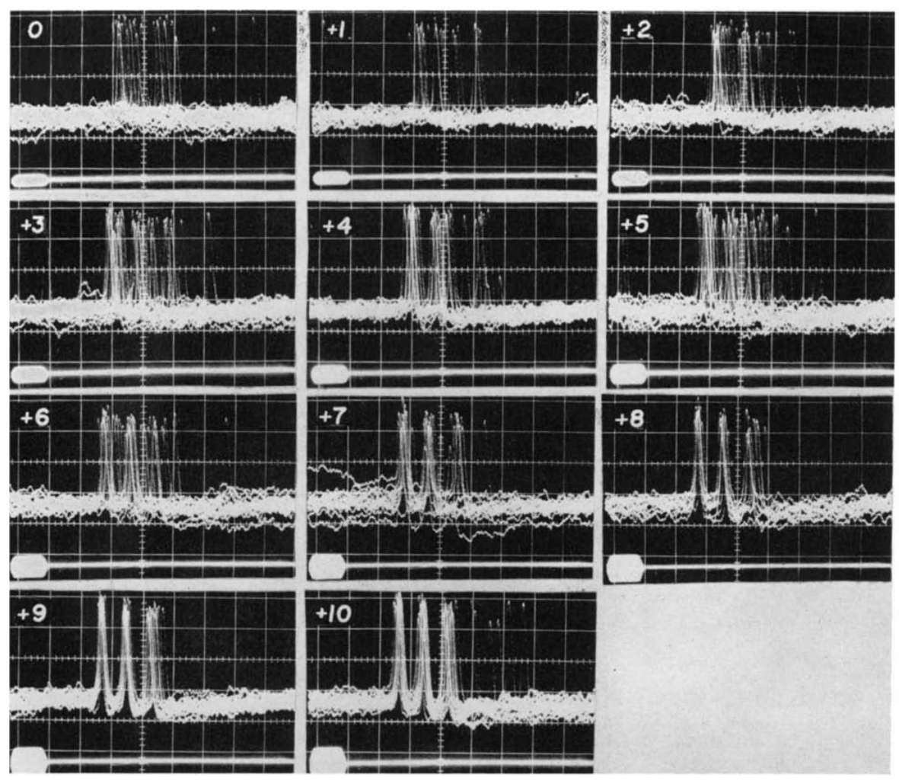
Stronger pulses shorten peripheral response latency
Roeder recorded tympanic responses to repeated short ultrasonic pulses while increasing amplitude in calibrated increments relative to an individual preparation’s threshold. This isolates changes in timing and spike count from changes in pulse frequency or duration.
After subtracting the 2.9-ms sound-transmission delay over 1 m, the biological response time ranged from approximately 3.2–4.0 ms near threshold to 1.9 ms at the strongest tested level. Timing was also more variable near threshold.
The shorter delay is consistent with faster excitation of the receptor as sound grows stronger. The generator potential was not successfully measured intracellularly, so its rate of rise remained an explanation rather than an observed mechanism. An external onset marker permits this latency measurement; a flying moth must obtain useful timing information from its own sensory signals.
Roeder & Treat (1957), Fig. 2. Published section through the ear and sensory attachment.
Roeder (1964), Fig. 2. Near-threshold responses at 1-dB increments.
Roeder (1964); Roeder & Treat (1957)
21
Notes:
• Roeder recorded tympanic responses to repeated short ultrasonic pulses while increasing amplitude in calibrated increments relative to an individual preparation’s threshold. This isolates changes in timing and spike count from changes in pulse frequency or duration.
• After subtracting the 2.9-ms sound-transmission delay over 1 m, the biological response time ranged from approximately 3.2–4.0 ms near threshold to 1.9 ms at the strongest tested level. Timing was also more variable near threshold.
– The biological delay still includes axonal conduction between the receptor and recording electrode. Roeder treated that component as approximately constant within the same preparation. Subtracting sound travel time avoids treating a physical delay through air as part of the neuron’s excitation process.
• The shorter delay is consistent with faster excitation of the receptor as sound grows stronger. The generator potential was not successfully measured intracellularly, so its rate of rise remained an explanation rather than an observed mechanism. An external onset marker permits this latency measurement; a flying moth must obtain useful timing information from its own sensory signals.
References:
Roeder KD (1964). Aspects of the noctuid tympanic nerve response having significance in the avoidance of bats. Journal of Insect Physiology 10: 529-546. https://doi.org/10.1016/0022-1910(64)90025-3
Roeder KD, Treat AE (1957). Ultrasonic reception by the tympanic organ of noctuid moths. Journal of Experimental Zoology 134: 127-157. https://doi.org/10.1002/jez.1401340107
Figure: Roeder (1964), Fig. 2. Near-threshold responses at 1-dB increments.
Figure source: https://doi.org/10.1016/0022-1910(64)90025-3
Figure: Roeder & Treat (1957), Fig. 2. Published section through the ear and sensory attachment.
Figure source: https://doi.org/10.1002/jez.1401340107

Slide 22
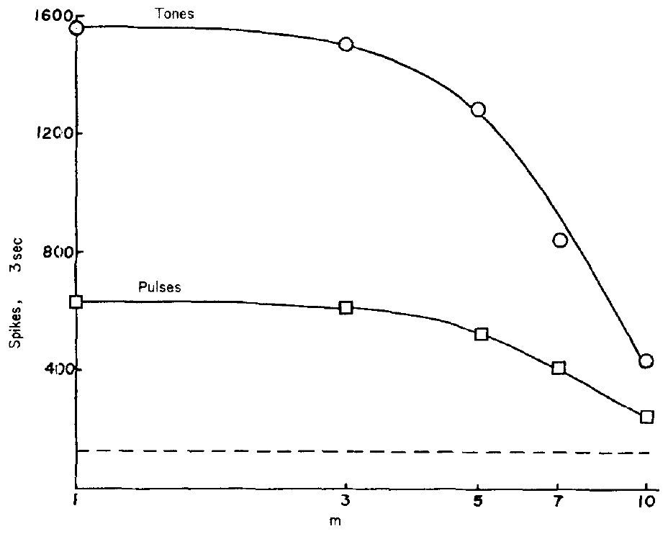
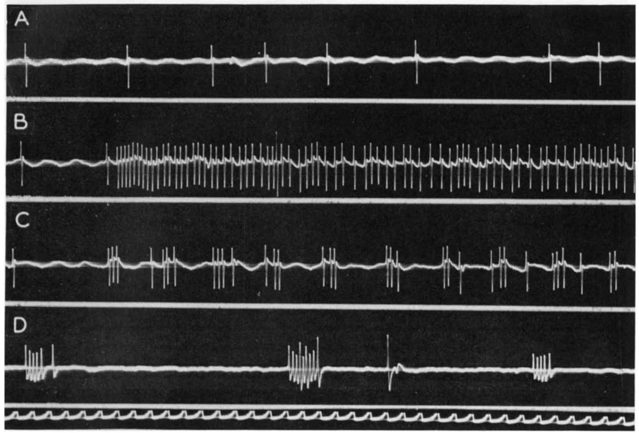
Total spike count does not predict pulse effectiveness
Roeder compared free-flight behavior during pulsed ultrasound and continuous tones of the same frequency and amplitude. Turning away occurred much more often with pulses, while tones elicited more total A1 spikes during a matched recording interval.
For the 60-kHz comparison, 3-ms pulses repeated 30 times per second were compared with a continuous tone. Recordings made at different source distances linked the same acoustic conditions to the nerve response.
Tones produced longer spike trains but adapted more rapidly; pulses repeatedly generated short-interval bursts. The result rejects total afferent spike count alone as a sufficient explanation of behavioral effectiveness. It supports sensitivity to temporal organization, without proving the exact central filter that selects the effective pattern.
Roeder (1964), Fig. 4. Spike counts for tones and pulses over distance.
Roeder (1964), Fig. 5(A–D). Spontaneous activity, tone, pulses and bat calls.
Roeder (1964)
22
Notes:
• Roeder compared free-flight behavior during pulsed ultrasound and continuous tones of the same frequency and amplitude. Turning away occurred much more often with pulses, while tones elicited more total A1 spikes during a matched recording interval.
• For the 60-kHz comparison, 3-ms pulses repeated 30 times per second were compared with a continuous tone. Recordings made at different source distances linked the same acoustic conditions to the nerve response.
– The field signals were alternated over the evening to reduce changes in the moth population as a confound. An initial observer-blind schedule reduced classification bias. Behavioral observations pooled unidentified flying moths, whereas nerve recordings came from identified preparations, limiting a precise neuron-to-behavior assignment.
• Tones produced longer spike trains but adapted more rapidly; pulses repeatedly generated short-interval bursts. The result rejects total afferent spike count alone as a sufficient explanation of behavioral effectiveness. It supports sensitivity to temporal organization, without proving the exact central filter that selects the effective pattern.
References:
Roeder KD (1964). Aspects of the noctuid tympanic nerve response having significance in the avoidance of bats. Journal of Insect Physiology 10: 529-546. https://doi.org/10.1016/0022-1910(64)90025-3
Figure: Roeder (1964), Fig. 4. Spike counts for tones and pulses over distance.
Figure source: https://doi.org/10.1016/0022-1910(64)90025-3
Figure: Roeder (1964), Fig. 5(A–D). Spontaneous activity, tone, pulses and bat calls.
Figure source: https://doi.org/10.1016/0022-1910(64)90025-3

Slide 23
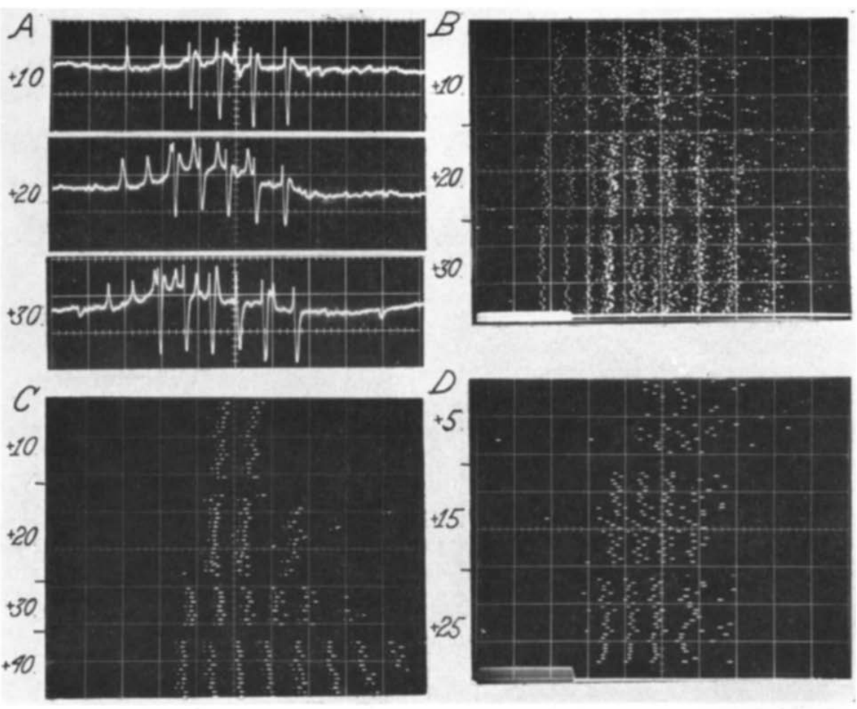
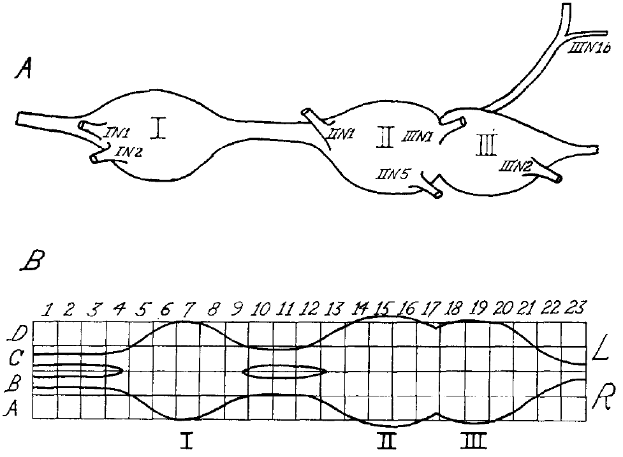
Thoracic repeaters relay the afferent burst
An interneuron is a central neuron connecting sensory input with other central processing or motor pathways. Roeder recorded sound-responsive activity within the thoracic ganglia, the central nerve-cell clusters associated with flight control.
Some units closely repeated the A1 burst but fired later. These repeater neurons included crossed responses passing to the opposite side and ipsilateral responses continuing toward the head. Simultaneously recorded A1 and repeater spikes differed in their temporal ordering.
The recordings establish central transmission of tympanic input and some transformation during longer stimuli. They do not establish a complete sequence of identified synapses. A synapse is a functional junction between neurons; the extracellular observations did not identify its transmitter, receptor subtype or postsynaptic ion channels.
Roeder (1966), Fig. 1(A–B). Thoracic ganglia and recording coordinates.
Roeder (1966), Fig. 4(A–D). Afferent and repeater responses with different timing.
Roeder (1966)
23
Notes:
• An **interneuron** is a central neuron connecting sensory input with other central processing or motor pathways. Roeder recorded sound-responsive activity within the thoracic ganglia, the central nerve-cell clusters associated with flight control.
• Some units closely repeated the A1 burst but fired later. These **repeater neurons** included crossed responses passing to the opposite side and ipsilateral responses continuing toward the head. Simultaneously recorded A1 and repeater spikes differed in their temporal ordering.
– Destroying one ear helped separate true crossed neural transmission from sound leaking acoustically to the opposite ear. Repeater output resembled A1 output closely enough that timing was essential for distinguishing them. Their eventual contribution to a particular wing movement was not determined.
• The recordings establish central transmission of tympanic input and some transformation during longer stimuli. They do not establish a complete sequence of identified synapses. A synapse is a functional junction between neurons; the extracellular observations did not identify its transmitter, receptor subtype or postsynaptic ion channels.
References:
Roeder KD (1966). Interneurons of the thoracic nerve cord activated by tympanic nerve fibres in noctuid moths. Journal of Insect Physiology 12: 1227-1244. https://doi.org/10.1016/0022-1910(66)90014-x
Figure: Roeder (1966), Fig. 4(A–D). Afferent and repeater responses with different timing.
Figure source: https://doi.org/10.1016/0022-1910(66)90014-x
Figure: Roeder (1966), Fig. 1(A–B). Thoracic ganglia and recording coordinates.
Figure source: https://doi.org/10.1016/0022-1910(66)90014-x

Slide 24
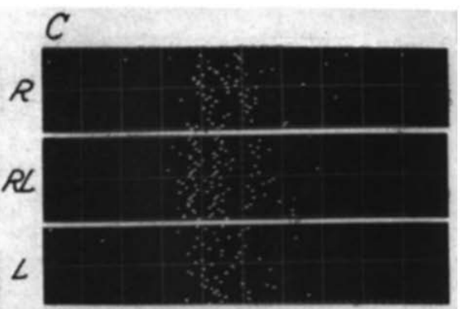
Bilateral summation differs from a direction comparator
Some recorded units responded to stimulation of either ear, and simultaneous stimulation produced a larger discharge. Bilateral summation combines input from the two sides rather than necessarily comparing which side received the stronger signal.
Roeder presented matched 5-ms ultrasonic pulses to the right ear, the left ear or both. A summating unit near the ganglion midline could produce a bilateral response resembling that evoked by stronger stimulation of one ear alone.
Such activity establishes convergence of auditory inputs but is insufficient by itself to identify a directional difference detector. Steering requires a relationship between side-specific information and motor output. The proposed subtraction or temporal-precedence mechanisms were not directly resolved by this recorded summating response.
Roeder (1966), Fig. 7(C). Responses to separate and simultaneous ear stimulation.
Roeder (1966), Fig. 1(A–B). Thoracic ganglia and recording coordinates.
Roeder (1966)
24
Notes:
• Some recorded units responded to stimulation of either ear, and simultaneous stimulation produced a larger discharge. **Bilateral summation** combines input from the two sides rather than necessarily comparing which side received the stronger signal.
• Roeder presented matched 5-ms ultrasonic pulses to the right ear, the left ear or both. A summating unit near the ganglion midline could produce a bilateral response resembling that evoked by stronger stimulation of one ear alone.
– A neuron that responds more when both ears are stimulated may encode overall input strength. It need not specify whether the source lies to the left or right. Roeder explicitly distinguished this observed summation from the still-undiscovered mechanism hypothesized to steer avoidance.
• Such activity establishes convergence of auditory inputs but is insufficient by itself to identify a directional difference detector. Steering requires a relationship between side-specific information and motor output. The proposed subtraction or temporal-precedence mechanisms were not directly resolved by this recorded summating response.
References:
Roeder KD (1966). Interneurons of the thoracic nerve cord activated by tympanic nerve fibres in noctuid moths. Journal of Insect Physiology 12: 1227-1244. https://doi.org/10.1016/0022-1910(66)90014-x
Figure: Roeder (1966), Fig. 7(C). Responses to separate and simultaneous ear stimulation.
Figure source: https://doi.org/10.1016/0022-1910(66)90014-x
Figure: Roeder (1966), Fig. 1(A–B). Thoracic ganglia and recording coordinates.
Figure source: https://doi.org/10.1016/0022-1910(66)90014-x

Slide 25
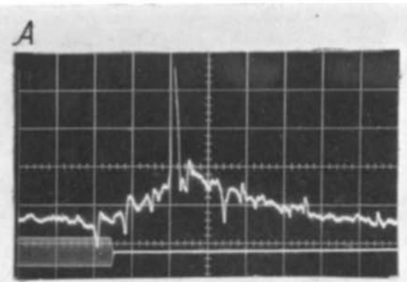
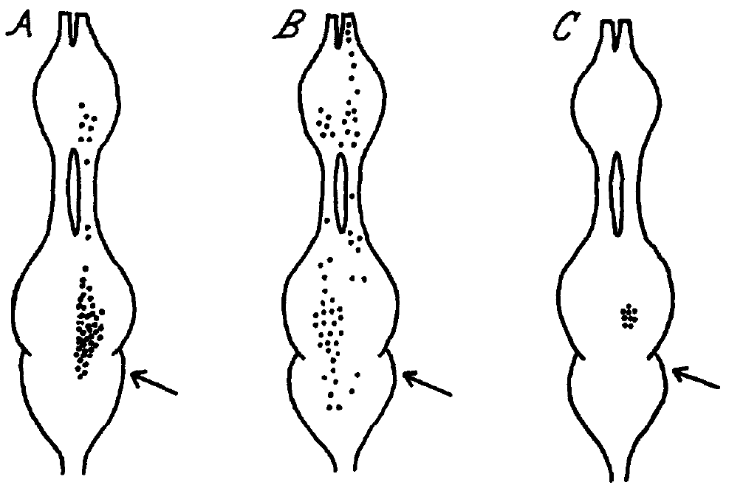
Pulse-marker units transform bursts into single events
A pulse-marker neuron usually generated one spike after an A1 burst, even when the burst contained several spikes. This transformation reduces the detailed duration information in the afferent train while retaining the occurrence of an acoustic event.
Roeder’s extracellular recordings associated the response with groups of three or four A1 impulses at intervals near 2 ms or less. For brief periods, the central unit could follow sound pulses repeated up to 40 times per second.
The response supports a temporal filtering operation rather than a faithful copy of every afferent spike. Temporal summation, the accumulation of excitation from closely spaced inputs, is consistent with the triggering requirement. The recordings did not directly identify the underlying synaptic current or establish that this unit alone initiates escape.
Roeder (1966), Fig. 6(A). Afferent bursts and pulse-marker spikes.
Roeder (1966), Fig. 8(A–C). Recorded afferent, relay and integrator locations.
Roeder (1966)
25
Notes:
• A **pulse-marker neuron** usually generated one spike after an A1 burst, even when the burst contained several spikes. This transformation reduces the detailed duration information in the afferent train while retaining the occurrence of an acoustic event.
• Roeder’s extracellular recordings associated the response with groups of three or four A1 impulses at intervals near 2 ms or less. For brief periods, the central unit could follow sound pulses repeated up to 40 times per second.
– The published location map represents where these response classes were encountered, not the complete morphology of each neuron. An A1 burst can contain information about duration and amplitude that is absent from the pulse-marker’s single output spike. The lost information may still exist in parallel pathways.
• The response supports a temporal filtering operation rather than a faithful copy of every afferent spike. **Temporal summation**, the accumulation of excitation from closely spaced inputs, is consistent with the triggering requirement. The recordings did not directly identify the underlying synaptic current or establish that this unit alone initiates escape.
References:
Roeder KD (1966). Interneurons of the thoracic nerve cord activated by tympanic nerve fibres in noctuid moths. Journal of Insect Physiology 12: 1227-1244. https://doi.org/10.1016/0022-1910(66)90014-x
Figure: Roeder (1966), Fig. 6(A). Afferent bursts and pulse-marker spikes.
Figure source: https://doi.org/10.1016/0022-1910(66)90014-x
Figure: Roeder (1966), Fig. 8(A–C). Recorded afferent, relay and integrator locations.
Figure source: https://doi.org/10.1016/0022-1910(66)90014-x

Slide 26
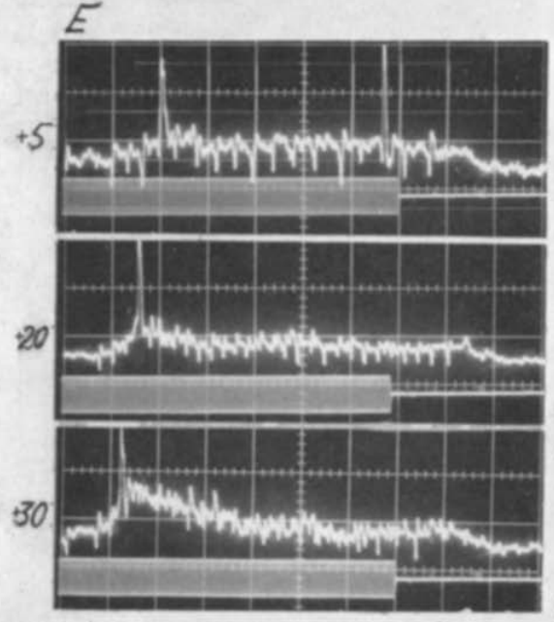
Pulse-marker recovery depends on the afferent pattern
The pulse-marker response depended on a preceding interval with reduced afferent activity. A long continuous A1 train often generated only one central spike, even when short interspike intervals continued after the initial response.
With 30–40-ms stimuli, stronger pulses could elicit one pulse-marker spike, whereas weaker, irregular afferent bursts sometimes elicited more than one. Pulse-marker latency shortened from a variable value near 20 ms to about 6 ms with increasing intensity.
A quiet interval may permit the unit to become responsive again, but the responsible cellular recovery process was not measured directly. These results constrain a simple rule in which stronger or longer sound necessarily produces more central spikes. The temporal arrangement of the afferent burst influences its central transformation.
Roeder (1966), Fig. 8(A–C). Recorded afferent, relay and integrator locations.
Roeder (1966), Fig. 6(E). Pulse-marker latency and output at three intensities.
Roeder (1966)
26
Notes:
• The pulse-marker response depended on a preceding interval with reduced afferent activity. A long continuous A1 train often generated only one central spike, even when short interspike intervals continued after the initial response.
• With 30–40-ms stimuli, stronger pulses could elicit one pulse-marker spike, whereas weaker, irregular afferent bursts sometimes elicited more than one. Pulse-marker latency shortened from a variable value near 20 ms to about 6 ms with increasing intensity.
– The term recovery describes the observed ability to respond again after reduced input, rather than naming a specific membrane conductance. Roeder proposed that gaps among irregular weak-input bursts could permit resetting. The contrast remained based on extracellular timing rather than direct intracellular measurement of that reset.
• A quiet interval may permit the unit to become responsive again, but the responsible cellular recovery process was not measured directly. These results constrain a simple rule in which stronger or longer sound necessarily produces more central spikes. The temporal arrangement of the afferent burst influences its central transformation.
References:
Roeder KD (1966). Interneurons of the thoracic nerve cord activated by tympanic nerve fibres in noctuid moths. Journal of Insect Physiology 12: 1227-1244. https://doi.org/10.1016/0022-1910(66)90014-x
Figure: Roeder (1966), Fig. 6(E). Pulse-marker latency and output at three intensities.
Figure source: https://doi.org/10.1016/0022-1910(66)90014-x
Figure: Roeder (1966), Fig. 8(A–C). Recorded afferent, relay and integrator locations.
Figure source: https://doi.org/10.1016/0022-1910(66)90014-x

Slide 27
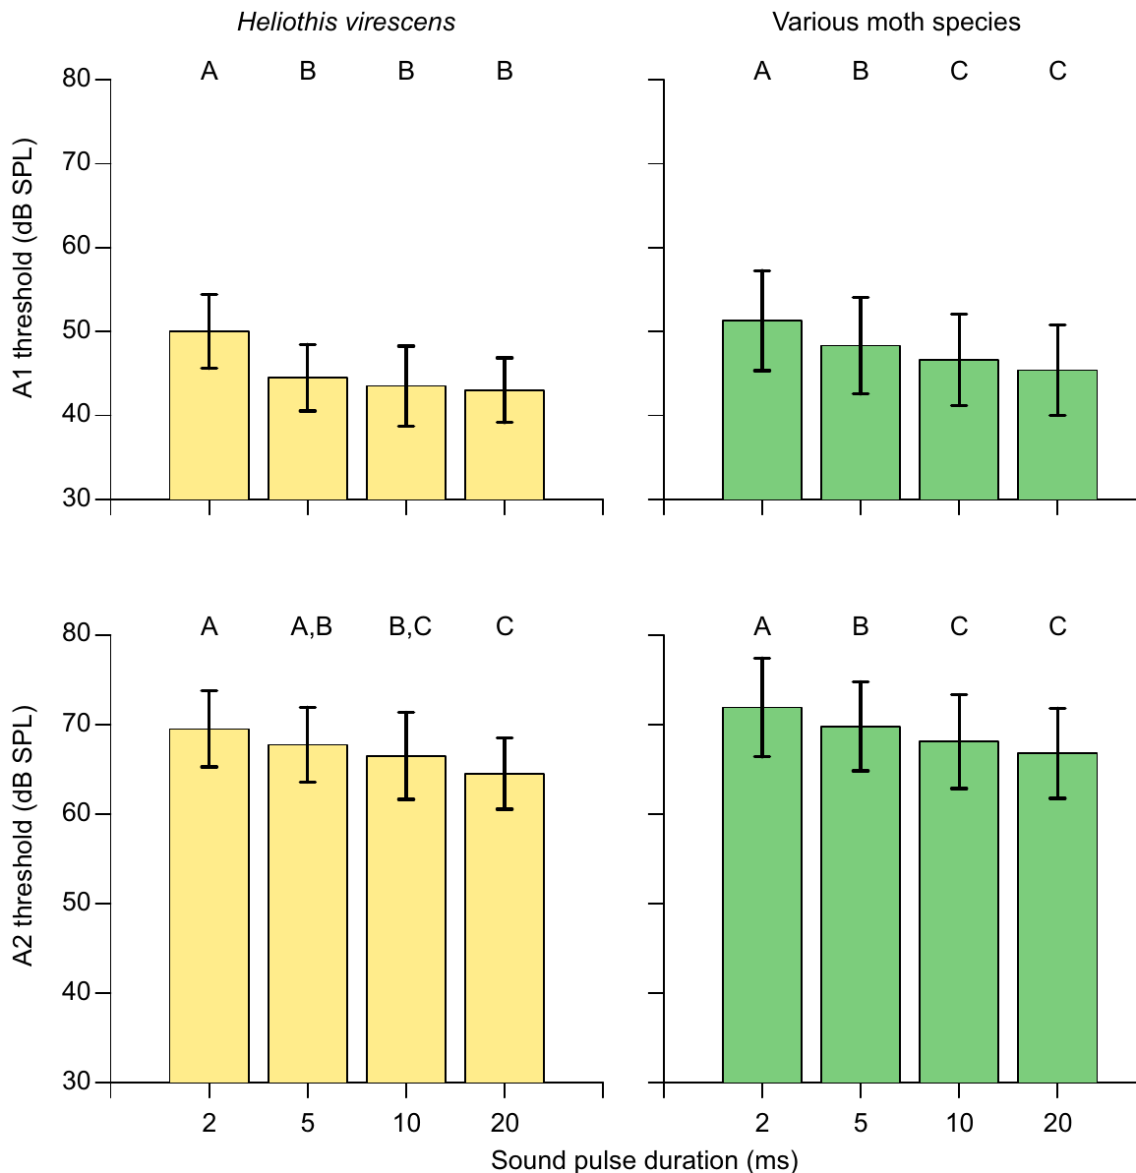
Longer sound pulses lower A1 and A2 thresholds
Gordon and ter Hofstede varied pulse duration while keeping the carrier at 50 kHz. The carrier frequency is the oscillation rate within each pulse, distinct from how often pulses repeat.
Both A1 and A2 generally required stronger sound for shorter pulses. In Heliothis virescens, the mean A1 threshold for a 2-ms pulse exceeded that for a 5-ms pulse by 5.5 dB. A2 thresholds decreased more gradually across the tested durations.
The dependence links stimulus duration to receptor sensitivity and changes when a moth can first detect a call. The result is consistent with temporal integration, but it does not identify the underlying conductance. A comparison of different bat calls must account for their duration as well as their level at the ear.
Roeder & Treat (1957), Fig. 2. Published section through the ear and sensory attachment.
Gordon & ter Hofstede (2018), Fig. 5. Duration dependence of A1 and A2 thresholds.
Gordon & ter Hofstede (2018); Roeder & Treat (1957)
27
Notes:
• Gordon and ter Hofstede varied pulse duration while keeping the carrier at 50 kHz. The **carrier frequency** is the oscillation rate within each pulse, distinct from how often pulses repeat.
• Both A1 and A2 generally required stronger sound for shorter pulses. In _Heliothis virescens_, the mean A1 threshold for a 2-ms pulse exceeded that for a 5-ms pulse by 5.5 dB. A2 thresholds decreased more gradually across the tested durations.
– Stimulus amplitudes were calibrated as peak-equivalent sound pressure level, using a sinusoid with the same peak-to-peak amplitude as the brief pulse. That convention differs from a meter average over silence and sound together. It permits duration effects to be interpreted against an explicit measure of pulse amplitude.
• The dependence links stimulus duration to receptor sensitivity and changes when a moth can first detect a call. The result is consistent with temporal integration, but it does not identify the underlying conductance. A comparison of different bat calls must account for their duration as well as their level at the ear.
References:
Gordon SD, ter Hofstede HM (2018). The influence of bat echolocation call duration and timing on auditory encoding of predator distance in noctuoid moths. Journal of Experimental Biology 221: jeb171561. https://doi.org/10.1242/jeb.171561
Roeder KD, Treat AE (1957). Ultrasonic reception by the tympanic organ of noctuid moths. Journal of Experimental Zoology 134: 127-157. https://doi.org/10.1002/jez.1401340107
Figure: Gordon & ter Hofstede (2018), Fig. 5. Duration dependence of A1 and A2 thresholds.
Figure source: https://doi.org/10.1242/jeb.171561
Figure: Roeder & Treat (1957), Fig. 2. Published section through the ear and sensory attachment.
Figure source: https://doi.org/10.1002/jez.1401340107

Slide 28
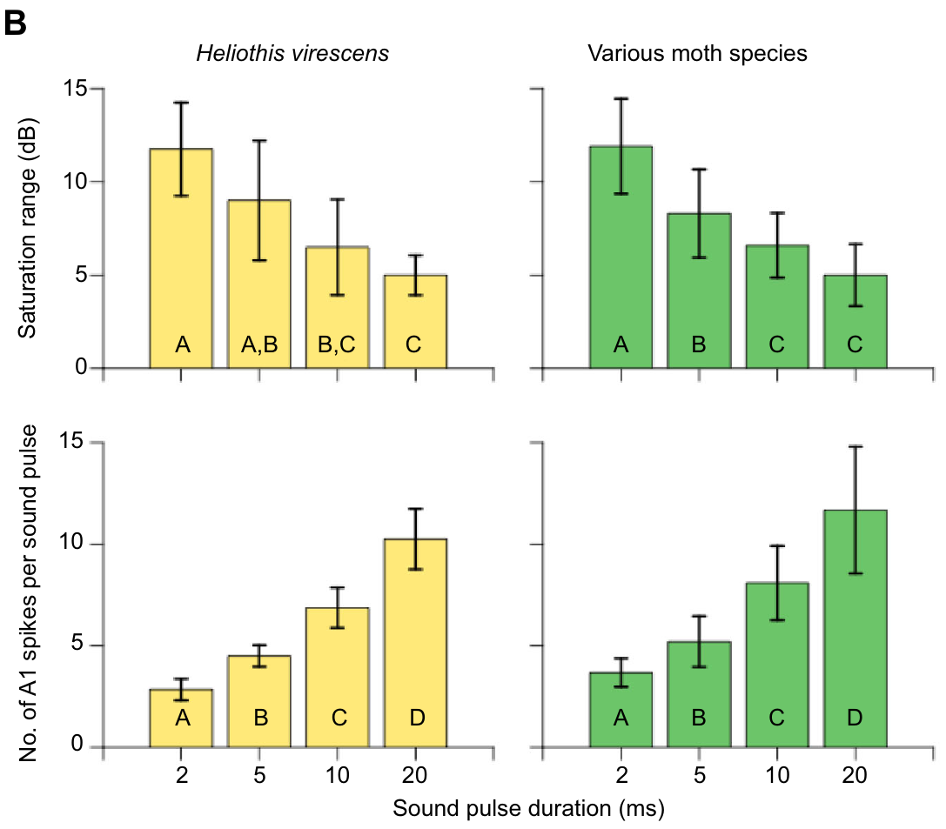
Short calls leave wider gaps in count-based intensity coding
The saturation range is the amplitude interval over which A1 spike count remains nearly unchanged before A2 begins responding. Gordon and ter Hofstede measured that interval separately from each cell’s threshold.
For 2-ms pulses, the plateau commonly contained only 2–5 A1 spikes per pulse. For 20-ms pulses, plateau counts ranged from 8–18 spikes per pulse. Shorter pulses generally left a wider saturation range below the A2 threshold.
More sensitive detection therefore does not guarantee fine intensity coding after detection. Increasing sound level may add little information through A1 spike count while A2 is still silent. These duration-dependent gaps constrain a continuously graded estimate of predator distance, without eliminating every possible cue available from timing or the opposite ear.
Roeder & Treat (1957), Fig. 2. Published section through the ear and sensory attachment.
Gordon & ter Hofstede (2018), Fig. 3(B). Saturation ranges and spike counts by duration.
Gordon & ter Hofstede (2018); Roeder & Treat (1957)
28
Notes:
• The **saturation range** is the amplitude interval over which A1 spike count remains nearly unchanged before A2 begins responding. Gordon and ter Hofstede measured that interval separately from each cell’s threshold.
• For 2-ms pulses, the plateau commonly contained only 2–5 A1 spikes per pulse. For 20-ms pulses, plateau counts ranged from 8–18 spikes per pulse. Shorter pulses generally left a wider saturation range below the A2 threshold.
– The bar plots summarize the range and count measures obtained from individual recordings. A higher number of spikes in a longer pulse is not evidence that the ear represents intensity more accurately at all levels; the relevant quantity is whether that count changes as intensity changes.
• More sensitive detection therefore does not guarantee fine intensity coding after detection. Increasing sound level may add little information through A1 spike count while A2 is still silent. These duration-dependent gaps constrain a continuously graded estimate of predator distance, without eliminating every possible cue available from timing or the opposite ear.
References:
Gordon SD, ter Hofstede HM (2018). The influence of bat echolocation call duration and timing on auditory encoding of predator distance in noctuoid moths. Journal of Experimental Biology 221: jeb171561. https://doi.org/10.1242/jeb.171561
Roeder KD, Treat AE (1957). Ultrasonic reception by the tympanic organ of noctuid moths. Journal of Experimental Zoology 134: 127-157. https://doi.org/10.1002/jez.1401340107
Figure: Gordon & ter Hofstede (2018), Fig. 3(B). Saturation ranges and spike counts by duration.
Figure source: https://doi.org/10.1242/jeb.171561
Figure: Roeder & Treat (1957), Fig. 2. Published section through the ear and sensory attachment.
Figure source: https://doi.org/10.1002/jez.1401340107

Slide 29
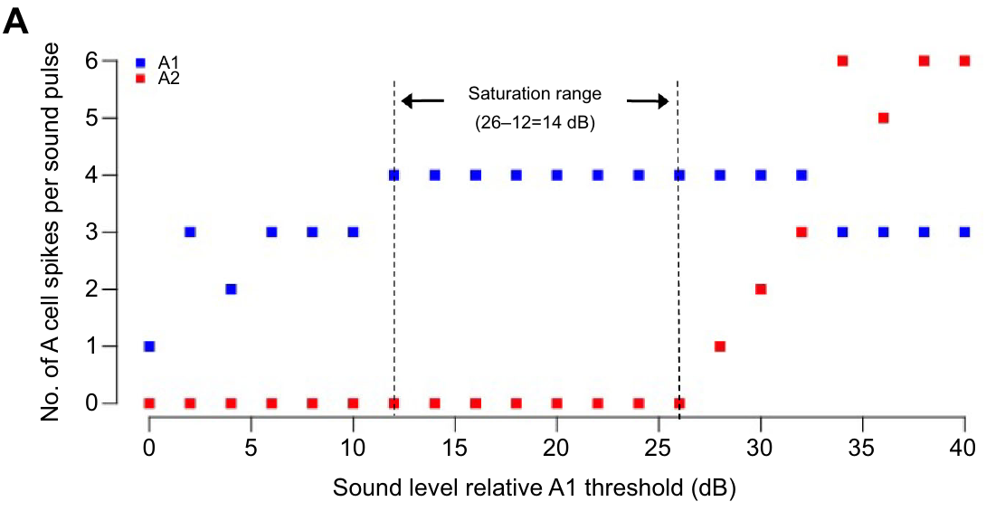
An A1 plateau can conceal increasing sound level
In the Raphia frater recording, a 2-ms, 50-kHz pulse elicited about four A1 spikes across an interval of increasing sound amplitudes. A2 remained silent during much of this plateau and was recruited only at higher levels.
The experiment increased amplitude systematically while the auditory nerve was recorded. The plateau therefore reflects repeated neural output to different controlled sound levels, rather than a constant input being measured repeatedly.
An approaching bat can become acoustically stronger without changing this selected output measure. The limitation concerns the count code within that range; it does not mean that the moth fails to hear the bat. Information about direction, stimulus history or a later A2 response may remain available through other response features.
Gordon & ter Hofstede (2018), Fig. 3(A). A1 saturation before A2 recruitment in Raphia frater.
Roeder & Treat (1957), Fig. 2. Published section through the ear and sensory attachment.
Gordon & ter Hofstede (2018); Roeder & Treat (1957)
29
Notes:
• In the _Raphia frater_ recording, a 2-ms, 50-kHz pulse elicited about four A1 spikes across an interval of increasing sound amplitudes. A2 remained silent during much of this plateau and was recruited only at higher levels.
• The experiment increased amplitude systematically while the auditory nerve was recorded. The plateau therefore reflects repeated neural output to different controlled sound levels, rather than a constant input being measured repeatedly.
– The figure labels the saturation interval relative to the individual A1 threshold. Relative dB values should not be confused with absolute sound pressure levels at the ear. The particular plateau belongs to this preparation, while the multi-species tests establish how commonly the pattern occurred.
• An approaching bat can become acoustically stronger without changing this selected output measure. The limitation concerns the count code within that range; it does not mean that the moth fails to hear the bat. Information about direction, stimulus history or a later A2 response may remain available through other response features.
References:
Gordon SD, ter Hofstede HM (2018). The influence of bat echolocation call duration and timing on auditory encoding of predator distance in noctuoid moths. Journal of Experimental Biology 221: jeb171561. https://doi.org/10.1242/jeb.171561
Roeder KD, Treat AE (1957). Ultrasonic reception by the tympanic organ of noctuid moths. Journal of Experimental Zoology 134: 127-157. https://doi.org/10.1002/jez.1401340107
Figure: Gordon & ter Hofstede (2018), Fig. 3(A). A1 saturation before A2 recruitment in Raphia frater.
Figure source: https://doi.org/10.1242/jeb.171561
Figure: Roeder & Treat (1957), Fig. 2. Published section through the ear and sensory attachment.
Figure source: https://doi.org/10.1002/jez.1401340107

Slide 30
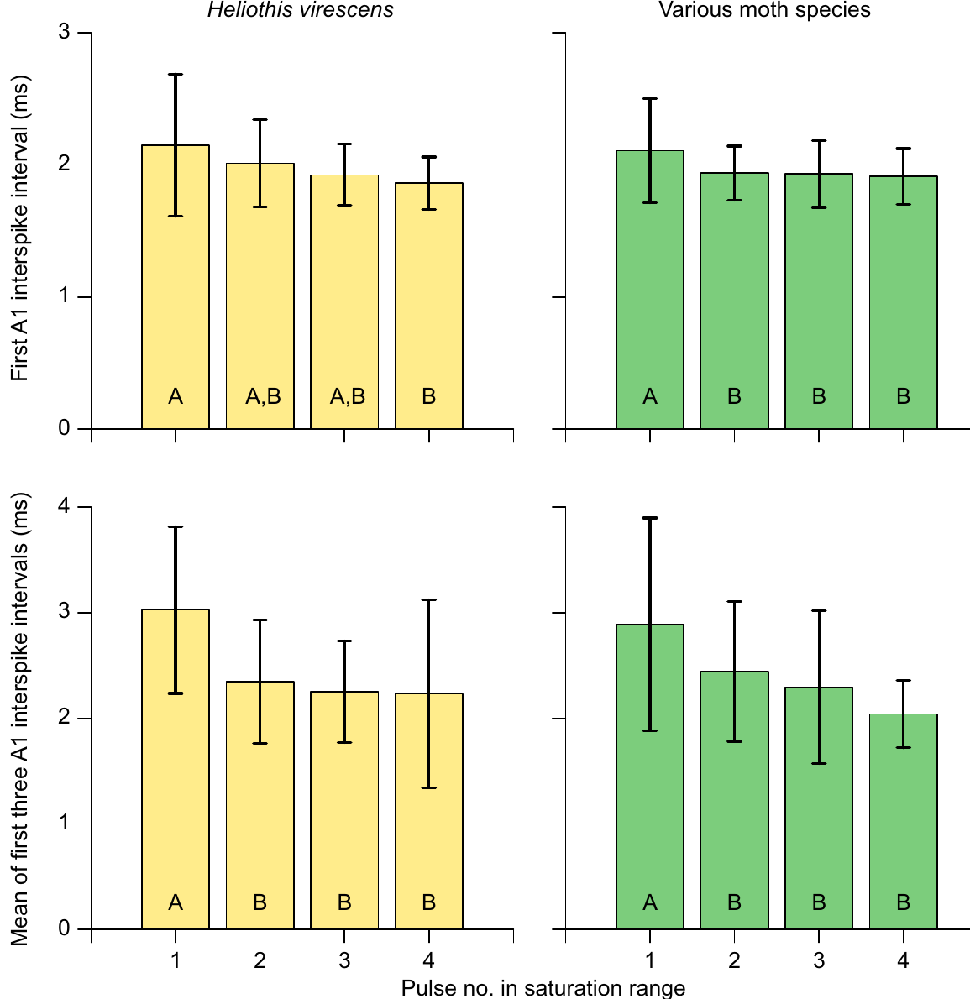
Spike intervals change little within the saturation range
An interspike interval is the time between successive action potentials. It can carry information even when spike count is unchanged, because the same number of spikes can be distributed differently in time.
Gordon and ter Hofstede examined A1 intervals during the short-pulse saturation range. Apart from a larger interval at the lowest sampled amplitude, the first interval and the mean of the initial intervals changed little as sound level increased.
This comparison constrains interval timing as an alternative continuous intensity code in that range. It does not negate Roeder’s evidence that tightly grouped bursts differ from spontaneous isolated spikes or adapted tone responses. Timing can identify a meaningful event without distinguishing every stronger amplitude once the response is saturated.
Roeder & Treat (1957), Fig. 2. Published section through the ear and sensory attachment.
Gordon & ter Hofstede (2018), Fig. 4. Interspike intervals within the saturation range.
Gordon & ter Hofstede (2018); Roeder & Treat (1957)
30
Notes:
• An **interspike interval** is the time between successive action potentials. It can carry information even when spike count is unchanged, because the same number of spikes can be distributed differently in time.
• Gordon and ter Hofstede examined A1 intervals during the short-pulse saturation range. Apart from a larger interval at the lowest sampled amplitude, the first interval and the mean of the initial intervals changed little as sound level increased.
– The experiment tests two different claims about timing: whether spikes form a burst, and whether the burst’s internal spacing encodes additional intensity differences. A reliable short interval can contribute to central excitation even if it changes little over the plateau.
• This comparison constrains interval timing as an alternative continuous intensity code in that range. It does not negate Roeder’s evidence that tightly grouped bursts differ from spontaneous isolated spikes or adapted tone responses. Timing can identify a meaningful event without distinguishing every stronger amplitude once the response is saturated.
References:
Gordon SD, ter Hofstede HM (2018). The influence of bat echolocation call duration and timing on auditory encoding of predator distance in noctuoid moths. Journal of Experimental Biology 221: jeb171561. https://doi.org/10.1242/jeb.171561
Roeder KD, Treat AE (1957). Ultrasonic reception by the tympanic organ of noctuid moths. Journal of Experimental Zoology 134: 127-157. https://doi.org/10.1002/jez.1401340107
Figure: Gordon & ter Hofstede (2018), Fig. 4. Interspike intervals within the saturation range.
Figure source: https://doi.org/10.1242/jeb.171561
Figure: Roeder & Treat (1957), Fig. 2. Published section through the ear and sensory attachment.
Figure source: https://doi.org/10.1002/jez.1401340107

Slide 31
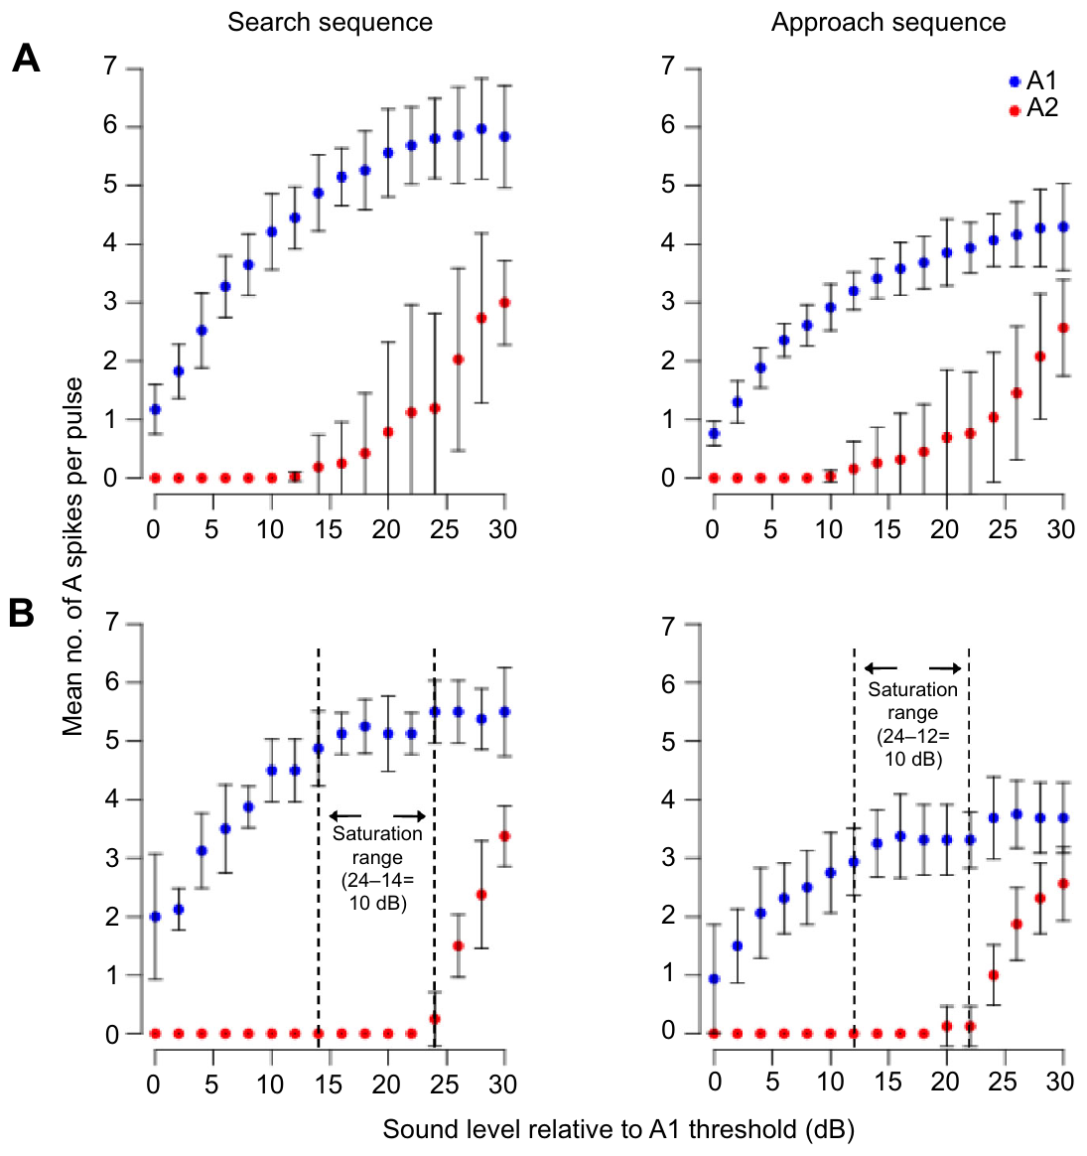
Bat-like pulse sequences preserve individual coding gaps
Gordon and ter Hofstede compared sequences modeled on searching and approaching bats. Search-like stimuli used 5-ms pulses every 75 ms, whereas approach-like stimuli used 2.5-ms pulses every 37.5 ms.
The sequences had the same duty cycle, the fraction of time occupied by sound, while differing in pulse duration and repetition rate. A1 and A2 output was measured as the amplitude of the entire sequence increased.
Averaged responses could appear smoothly graded, but individual moths retained A1 saturation ranges of 4–12 dB before A2 recruitment. Population averaging therefore concealed some within-animal coding gaps. The sequences approximate bat timing; they do not reproduce every natural frequency sweep, directional change or amplitude trajectory of an attack.
Roeder & Treat (1957), Fig. 2. Published section through the ear and sensory attachment.
Gordon & ter Hofstede (2018), Fig. 6(A–B). Search- and approach-like pulse-sequence responses.
Gordon & ter Hofstede (2018); Roeder & Treat (1957)
31
Notes:
• Gordon and ter Hofstede compared sequences modeled on searching and approaching bats. Search-like stimuli used 5-ms pulses every 75 ms, whereas approach-like stimuli used 2.5-ms pulses every 37.5 ms.
• The sequences had the same duty cycle, the fraction of time occupied by sound, while differing in pulse duration and repetition rate. A1 and A2 output was measured as the amplitude of the entire sequence increased.
– A moth receives its own receptor output rather than the average across many individuals. One individual’s plateau can occur at a different relative amplitude from another’s, making the pooled curve smoother than any one receptor response. The matching duty cycle controls one aspect of the acoustic sequence while deliberately varying others.
• Averaged responses could appear smoothly graded, but individual moths retained A1 saturation ranges of 4–12 dB before A2 recruitment. Population averaging therefore concealed some within-animal coding gaps. The sequences approximate bat timing; they do not reproduce every natural frequency sweep, directional change or amplitude trajectory of an attack.
References:
Gordon SD, ter Hofstede HM (2018). The influence of bat echolocation call duration and timing on auditory encoding of predator distance in noctuoid moths. Journal of Experimental Biology 221: jeb171561. https://doi.org/10.1242/jeb.171561
Roeder KD, Treat AE (1957). Ultrasonic reception by the tympanic organ of noctuid moths. Journal of Experimental Zoology 134: 127-157. https://doi.org/10.1002/jez.1401340107
Figure: Gordon & ter Hofstede (2018), Fig. 6(A–B). Search- and approach-like pulse-sequence responses.
Figure source: https://doi.org/10.1242/jeb.171561
Figure: Roeder & Treat (1957), Fig. 2. Published section through the ear and sensory attachment.
Figure source: https://doi.org/10.1002/jez.1401340107

Slide 32
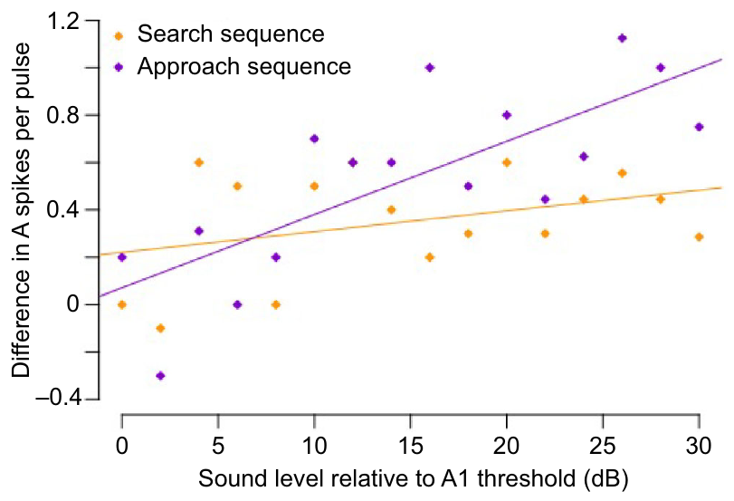
Approach-like sequences adapt more at higher amplitudes
The effect of repeated pulses depended on both timing and sound level. Gordon and ter Hofstede compared A1 spikes after the first and last pulse in each search-like or approach-like sequence.
Search-like sequences showed little systematic decline, even at high levels. In approach-like sequences, stronger stimulation produced fewer spikes near the sequence’s end; the mean first-to-last difference exceeded half a spike per pulse only above 10 dB relative to A1 threshold.
Adaptation therefore cannot be assumed simply because sound repeats. Its expression depends on the input pattern and receptor operating range. These measurements concern the peripheral nerve; they do not identify a central state change or establish how the same decline alters an individual moth’s flight.
Gordon & ter Hofstede (2018), Fig. 7. Adaptation within search- and approach-like sequences.
Roeder & Treat (1957), Fig. 2. Published section through the ear and sensory attachment.
Gordon & ter Hofstede (2018); Roeder & Treat (1957)
32
Notes:
• The effect of repeated pulses depended on both timing and sound level. Gordon and ter Hofstede compared A1 spikes after the first and last pulse in each search-like or approach-like sequence.
• Search-like sequences showed little systematic decline, even at high levels. In approach-like sequences, stronger stimulation produced fewer spikes near the sequence’s end; the mean first-to-last difference exceeded half a spike per pulse only above 10 dB relative to A1 threshold.
– The first and last pulses are compared at the same sequence amplitude. The decline therefore reflects stimulus history within the sequence, rather than a planned reduction in acoustic intensity. The authors did not test terminal-buzz repetition rates in this experiment.
• Adaptation therefore cannot be assumed simply because sound repeats. Its expression depends on the input pattern and receptor operating range. These measurements concern the peripheral nerve; they do not identify a central state change or establish how the same decline alters an individual moth’s flight.
References:
Gordon SD, ter Hofstede HM (2018). The influence of bat echolocation call duration and timing on auditory encoding of predator distance in noctuoid moths. Journal of Experimental Biology 221: jeb171561. https://doi.org/10.1242/jeb.171561
Roeder KD, Treat AE (1957). Ultrasonic reception by the tympanic organ of noctuid moths. Journal of Experimental Zoology 134: 127-157. https://doi.org/10.1002/jez.1401340107
Figure: Gordon & ter Hofstede (2018), Fig. 7. Adaptation within search- and approach-like sequences.
Figure source: https://doi.org/10.1242/jeb.171561
Figure: Roeder & Treat (1957), Fig. 2. Published section through the ear and sensory attachment.
Figure source: https://doi.org/10.1002/jez.1401340107

Slide 33
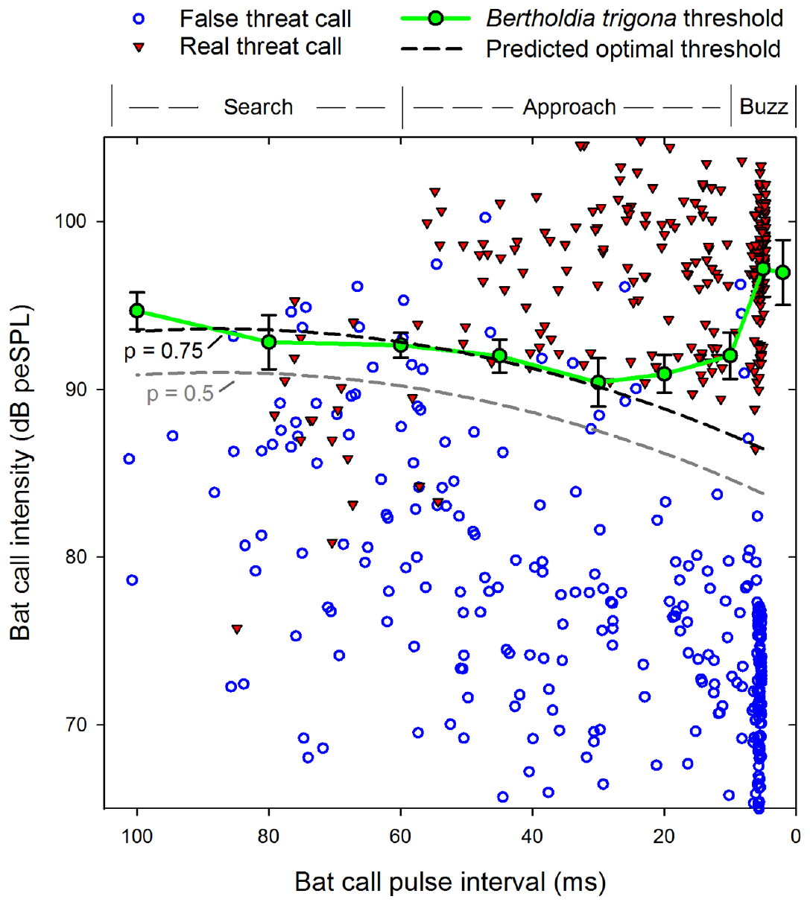
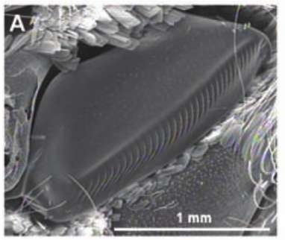
Clicking thresholds depend on bat-like pulse timing
The tiger moth Bertholdia trigona produces defensive ultrasonic clicks using a tymbal, a sound-producing structure distinct from the tympanum that receives sound. Corcoran and colleagues measured the input levels required to trigger clicking.
Laboratory playbacks used 40-kHz pulses of 2-ms duration, with intensity rising from 70 to 120 dB SPL. Pulse intervals were varied to represent different stages of bat echolocation, and the first moth click defined the behavioral threshold.
The lowest clicking thresholds occurred at intervals of 20–30 ms, resembling late approach calls. Search-like and very rapid terminal timing required greater sound levels. This is a behavioral response curve rather than a receptor audiogram: hearing a pulse and deciding to emit a defensive signal are different measured events.
Corcoran et al. (2009), Fig. 1(A). Sound-producing tymbal; scale bar 1 mm.
Corcoran et al. (2013), Fig. 4. Measured clicking thresholds and real/false threat calls.
Corcoran et al. (2013); Corcoran et al. (2009)
33
Notes:
• The tiger moth _Bertholdia trigona_ produces defensive ultrasonic clicks using a **tymbal**, a sound-producing structure distinct from the tympanum that receives sound. Corcoran and colleagues measured the input levels required to trigger clicking.
• Laboratory playbacks used 40-kHz pulses of 2-ms duration, with intensity rising from 70 to 120 dB SPL. Pulse intervals were varied to represent different stages of bat echolocation, and the first moth click defined the behavioral threshold.
– The playbacks were stopped when clicking began, and silent intervals separated presentations. This reduces contamination by a continuing defensive response from the preceding test. The tymbal photograph identifies the output organ, while the threshold experiment concerns the sensory conditions that activate it.
• The lowest clicking thresholds occurred at intervals of 20–30 ms, resembling late approach calls. Search-like and very rapid terminal timing required greater sound levels. This is a behavioral response curve rather than a receptor audiogram: hearing a pulse and deciding to emit a defensive signal are different measured events.
References:
Corcoran AJ, Wagner RD, Conner WE (2013). Optimal Predator Risk Assessment by the Sonar-Jamming Arctiine Moth Bertholdia trigona. PLoS ONE 8: e63609. https://doi.org/10.1371/journal.pone.0063609
Corcoran AJ, Barber JR, Conner WE (2009). Tiger Moth Jams Bat Sonar. Science 325: 325-327. https://doi.org/10.1126/science.1174096
Figure: Corcoran et al. (2013), Fig. 4. Measured clicking thresholds and real/false threat calls.
Figure source: https://doi.org/10.1371/journal.pone.0063609
Figure: Corcoran et al. (2009), Fig. 1(A). Sound-producing tymbal; scale bar 1 mm.
Figure source: https://doi.org/10.1126/science.1174096

Slide 34
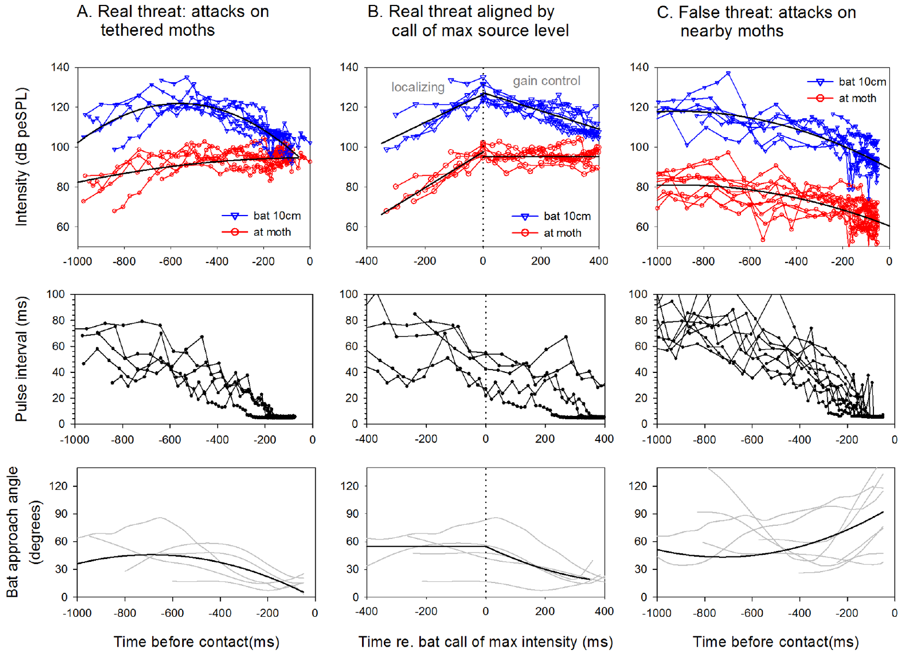
Targeted attacks differ acoustically from nearby attacks
A moth can hear a bat that is attacking another insect. Corcoran and colleagues defined a real threat as an attack on the focal moth and a false threat as an attack on a neighboring free-flying moth.
Synchronized infrared video and ultrasonic recordings estimated call pressure at the focal moth while reconstructing bat position. During real attacks, received intensity generally increased before leveling late in the approach. During false threats, intensity at the non-target moth tended to decrease.
Pulse intervals shortened in both circumstances, so increasing call rate alone did not uniquely identify the victim. The contrast supports combined use of timing and received level. Field amplitudes used peak-equivalent sound pressure level (peSPL), matched to the peak amplitude of a reference sinusoid. The field comparison establishes available cues, but it does not directly record the neural computation that differentiates the two situations.
Corcoran et al. (2013), Fig. 5(A–C). Call levels and flight parameters during real/false threats.
Corcoran et al. (2013)
34
Notes:
• A moth can hear a bat that is attacking another insect. Corcoran and colleagues defined a **real threat** as an attack on the focal moth and a **false threat** as an attack on a neighboring free-flying moth.
• Synchronized infrared video and ultrasonic recordings estimated call pressure at the focal moth while reconstructing bat position. During real attacks, received intensity generally increased before leveling late in the approach. During false threats, intensity at the non-target moth tended to decrease.
– The bat’s emitted intensity and the intensity arriving at a moth are separate quantities. Beam orientation, distance and source-level changes all influence the received signal. The investigators therefore estimated pressure at the insect rather than relying only on the bat’s call timing.
• Pulse intervals shortened in both circumstances, so increasing call rate alone did not uniquely identify the victim. The contrast supports combined use of timing and received level. Field amplitudes used peak-equivalent sound pressure level (peSPL), matched to the peak amplitude of a reference sinusoid. The field comparison establishes available cues, but it does not directly record the neural computation that differentiates the two situations.
References:
Corcoran AJ, Wagner RD, Conner WE (2013). Optimal Predator Risk Assessment by the Sonar-Jamming Arctiine Moth Bertholdia trigona. PLoS ONE 8: e63609. https://doi.org/10.1371/journal.pone.0063609
Figure: Corcoran et al. (2013), Fig. 5(A–C). Call levels and flight parameters during real/false threats.
Figure source: https://doi.org/10.1371/journal.pone.0063609

Slide 35
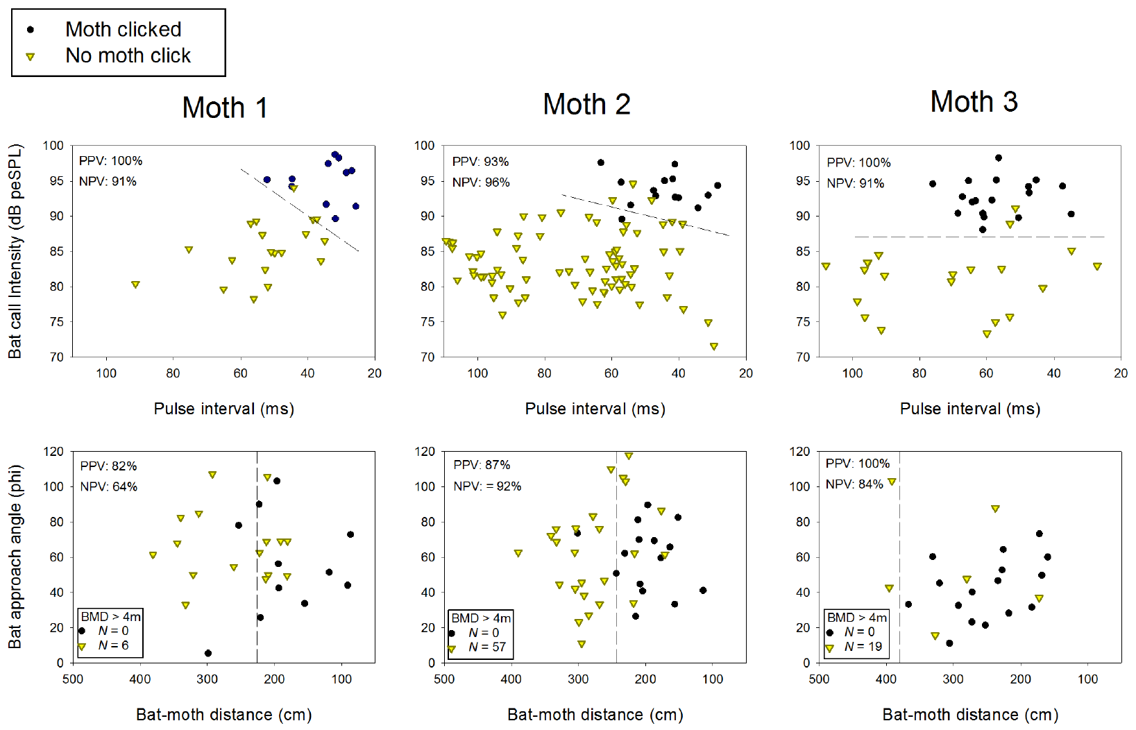
Field clicking begins during early-to-middle approach
Corcoran and colleagues recorded free-flying bats passing tethered Bertholdia trigona and compared encounters that elicited clicks with those that did not. The focal moths could hear and click, but their flight trajectories were constrained.
Clicking usually began during early-to-middle approach, with bat pulse intervals of 25–60 ms. Sound level at the moth discriminated clicking from silent passes more consistently than bat distance or flight approach angle alone.
These observations link natural acoustic input with the onset of a defensive output. They do not establish that tethered and freely flying moths respond identically, or that a fixed distance determines clicking. Timing depends on what the insect receives acoustically, including whether the bat directs its calls toward it.
Corcoran et al. (2013), Fig. 6, first two rows. Clicking versus silent passes by acoustic and distance cues.
Corcoran et al. (2013)
35
Notes:
• Corcoran and colleagues recorded free-flying bats passing tethered _Bertholdia trigona_ and compared encounters that elicited clicks with those that did not. The focal moths could hear and click, but their flight trajectories were constrained.
• Clicking usually began during early-to-middle approach, with bat pulse intervals of 25–60 ms. Sound level at the moth discriminated clicking from silent passes more consistently than bat distance or flight approach angle alone.
– A close bat may remain acoustically weak at the focal moth if its beam points elsewhere. Conversely, a directed sequence can identify an escalating threat before a major change in flight approach angle. The laboratory threshold test and field observations address complementary input–output conditions.
• These observations link natural acoustic input with the onset of a defensive output. They do not establish that tethered and freely flying moths respond identically, or that a fixed distance determines clicking. Timing depends on what the insect receives acoustically, including whether the bat directs its calls toward it.
References:
Corcoran AJ, Wagner RD, Conner WE (2013). Optimal Predator Risk Assessment by the Sonar-Jamming Arctiine Moth Bertholdia trigona. PLoS ONE 8: e63609. https://doi.org/10.1371/journal.pone.0063609
Figure: Corcoran et al. (2013), Fig. 6, first two rows. Clicking versus silent passes by acoustic and distance cues.
Figure source: https://doi.org/10.1371/journal.pone.0063609

Slide 36
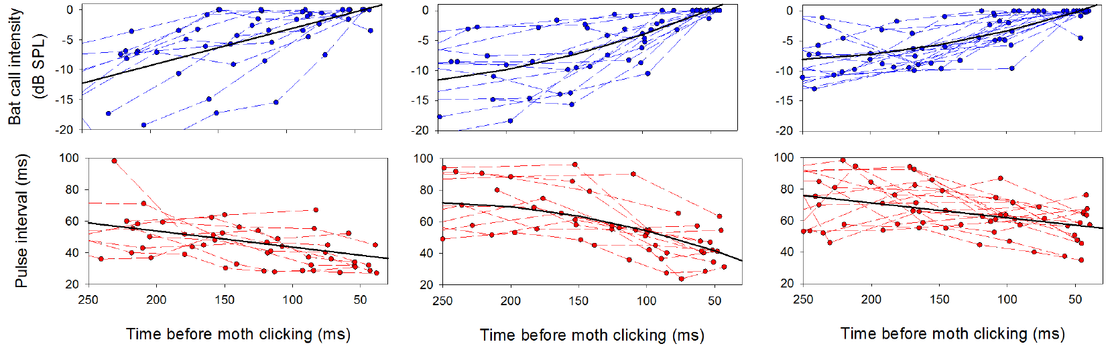
Rising call levels precede defensive clicking
During the interval preceding defensive clicks, bat calls increased in received intensity while their pulse intervals became slightly shorter. Corcoran and colleagues measured these changes over the 250 ms before clicking onset.
The acoustic combination is consistent with a bat detecting and targeting the moth. In real attacks, received intensity could subsequently plateau near 95 dB peSPL while the bat reduced its source output as it approached.
A decreasing emitted level therefore need not mean decreasing threat at the prey. Geometry and source regulation jointly shape the signal that reaches the ear. The association supports threat-sensitive timing of the defense, but the study did not establish the exact receptor or interneuron computation that triggers the first click.
Corcoran et al. (2013), Fig. 6, last two rows. Call-level and pulse-interval changes preceding clicks.
Corcoran et al. (2013)
36
Notes:
• During the interval preceding defensive clicks, bat calls increased in received intensity while their pulse intervals became slightly shorter. Corcoran and colleagues measured these changes over the 250 ms before clicking onset.
• The acoustic combination is consistent with a bat detecting and targeting the moth. In real attacks, received intensity could subsequently plateau near 95 dB peSPL while the bat reduced its source output as it approached.
– Call-level and interval changes were measured relative to clicking onset. The claim concerns changes before a measured behavioral event. Selection for efficient timing was proposed by the authors; the field records alone do not demonstrate the evolutionary process that produced it.
• A decreasing emitted level therefore need not mean decreasing threat at the prey. Geometry and source regulation jointly shape the signal that reaches the ear. The association supports threat-sensitive timing of the defense, but the study did not establish the exact receptor or interneuron computation that triggers the first click.
References:
Corcoran AJ, Wagner RD, Conner WE (2013). Optimal Predator Risk Assessment by the Sonar-Jamming Arctiine Moth Bertholdia trigona. PLoS ONE 8: e63609. https://doi.org/10.1371/journal.pone.0063609
Figure: Corcoran et al. (2013), Fig. 6, last two rows. Call-level and pulse-interval changes preceding clicks.
Figure source: https://doi.org/10.1371/journal.pone.0063609

Slide 37
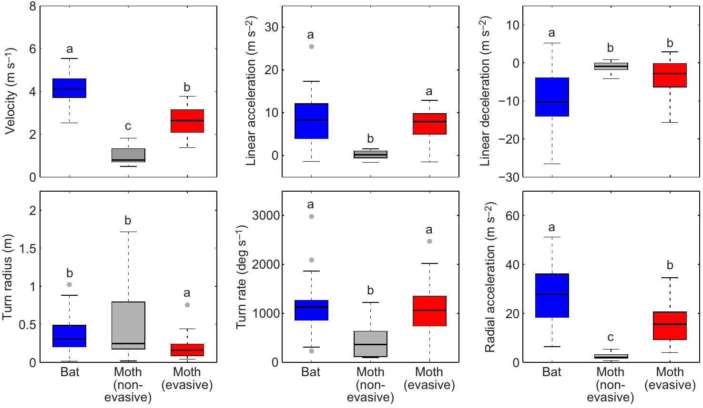
Escape does not require greater speed than the bat
Corcoran and Conner compared maximum flight performance during measured bat–moth encounters. Bats exceeded evasive moths in speed and several acceleration measures, yet many evasive moths escaped.
The bats’ advantage also included tighter minimum turn radii and greater peak turning performance. Non-evasive prey generally performed worse than evasive prey, but comparing maximum values alone did not determine the outcome of a chase.
A moth can exploit the timing and geometry of a maneuver rather than outrunning the bat along the same path. The comparison concerns the recorded movements within this predator and prey assemblage. It does not establish a universal performance ranking for all bats and moths.
Corcoran & Conner (2016), Fig. 5. Bat and moth flight performance.
Corcoran & Conner (2016)
37
Notes:
• Corcoran and Conner compared maximum flight performance during measured bat–moth encounters. Bats exceeded evasive moths in speed and several acceleration measures, yet many evasive moths escaped.
• The bats’ advantage also included tighter minimum turn radii and greater peak turning performance. Non-evasive prey generally performed worse than evasive prey, but comparing maximum values alone did not determine the outcome of a chase.
– Peak performance is the strongest measured movement during an encounter, not necessarily the movement occurring simultaneously in predator and prey. A bat capable of a superior maximum can still be unable to follow a specific sudden turn at the required moment.
• A moth can exploit the timing and geometry of a maneuver rather than outrunning the bat along the same path. The comparison concerns the recorded movements within this predator and prey assemblage. It does not establish a universal performance ranking for all bats and moths.
References:
Corcoran AJ, Conner WE (2016). How moths escape bats: predicting outcomes of predator-prey interactions. Journal of Experimental Biology 219: 2704–2715. https://doi.org/10.1242/jeb.137638
Figure: Corcoran & Conner (2016), Fig. 5. Bat and moth flight performance.
Figure source: https://doi.org/10.1242/jeb.137638

Slide 38
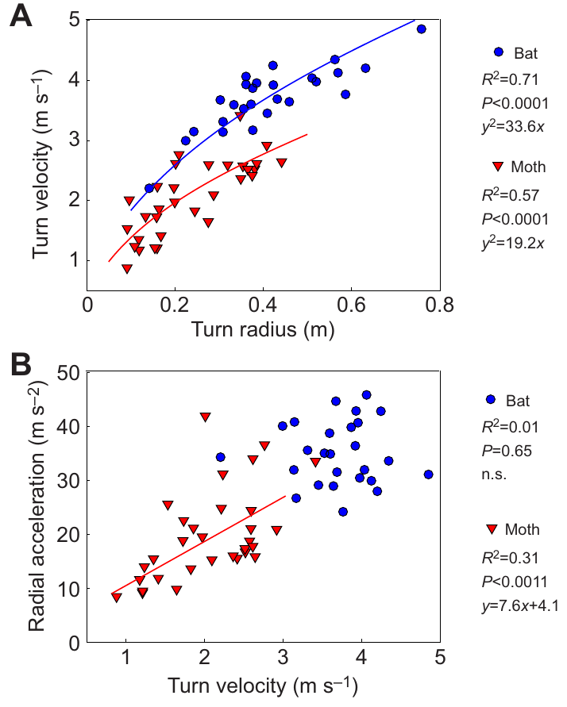
Turning performance combines speed and turn radius
Radial acceleration describes the change in velocity direction during a curved turn. A tighter turn at a given speed requires greater radial acceleration; speed alone omits the geometry of the motion.
Corcoran and Conner extracted turn speed, radius and radial acceleration from reconstructed flight paths. Moth radial acceleration increased with turn speed, whereas bat radial acceleration was much less dependent on turn speed in the measured range.
These differences constrain the maneuvers available during pursuit. They do not imply that a moth must exceed the bat’s maximum acceleration to survive. The relevant outcome depends on whether a particular turn changes the interception path before the bat can follow it, rather than on one isolated performance value.
Corcoran & Conner (2016), Fig. 6(A–B). Turn speed, radius and radial acceleration.
Corcoran & Conner (2016)
38
Notes:
• **Radial acceleration** describes the change in velocity direction during a curved turn. A tighter turn at a given speed requires greater radial acceleration; speed alone omits the geometry of the motion.
• Corcoran and Conner extracted turn speed, radius and radial acceleration from reconstructed flight paths. Moth radial acceleration increased with turn speed, whereas bat radial acceleration was much less dependent on turn speed in the measured range.
– A minimum turn radius and a maximum speed measured at different moments should not be combined as though they occurred together. The study examined relationships among simultaneously measured turn variables, which preserves the physical relationship within each maneuver.
• These differences constrain the maneuvers available during pursuit. They do not imply that a moth must exceed the bat’s maximum acceleration to survive. The relevant outcome depends on whether a particular turn changes the interception path before the bat can follow it, rather than on one isolated performance value.
References:
Corcoran AJ, Conner WE (2016). How moths escape bats: predicting outcomes of predator-prey interactions. Journal of Experimental Biology 219: 2704–2715. https://doi.org/10.1242/jeb.137638
Figure: Corcoran & Conner (2016), Fig. 6(A–B). Turn speed, radius and radial acceleration.
Figure source: https://doi.org/10.1242/jeb.137638

Slide 39
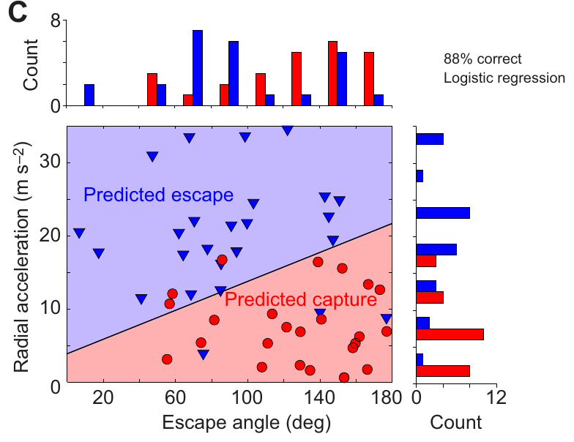
Sharp turns and smaller escape angles favor survival
The escape angle is the direction of the moth’s movement relative to the approaching predator. Corcoran and Conner measured it after the initial evasive turn, along with the moth’s radial acceleration.
Moths escaping with angles of 40–100° survived more often than those taking angles above 100°. Escaping prey averaged an angle near 83°, whereas captured prey averaged near 126°. Greater radial acceleration also distinguished successful maneuvers.
Turning partly toward or across the approaching bat can therefore be more effective than continuing directly away during a chase. These are measured associations within the tested encounters, not a command that every moth should follow one fixed angle. The sensory and motor mechanisms choosing the trajectory were not identified.
Corcoran & Conner (2016), Fig. 7(C). Escape outcomes by angle and radial acceleration.
Corcoran & Conner (2016)
39
Notes:
• The **escape angle** is the direction of the moth’s movement relative to the approaching predator. Corcoran and Conner measured it after the initial evasive turn, along with the moth’s radial acceleration.
• Moths escaping with angles of 40–100° survived more often than those taking angles above 100°. Escaping prey averaged an angle near 83°, whereas captured prey averaged near 126°. Greater radial acceleration also distinguished successful maneuvers.
– The escape angle is different from the initial direction of travel before the evasive turn. The source comparison concerns the maneuver’s resulting geometry. High radial acceleration allows rapid redirection, while the angle determines where that redirection places the moth relative to interception.
• Turning partly toward or across the approaching bat can therefore be more effective than continuing directly away during a chase. These are measured associations within the tested encounters, not a command that every moth should follow one fixed angle. The sensory and motor mechanisms choosing the trajectory were not identified.
References:
Corcoran AJ, Conner WE (2016). How moths escape bats: predicting outcomes of predator-prey interactions. Journal of Experimental Biology 219: 2704–2715. https://doi.org/10.1242/jeb.137638
Figure: Corcoran & Conner (2016), Fig. 7(C). Escape outcomes by angle and radial acceleration.
Figure source: https://doi.org/10.1242/jeb.137638

Slide 40
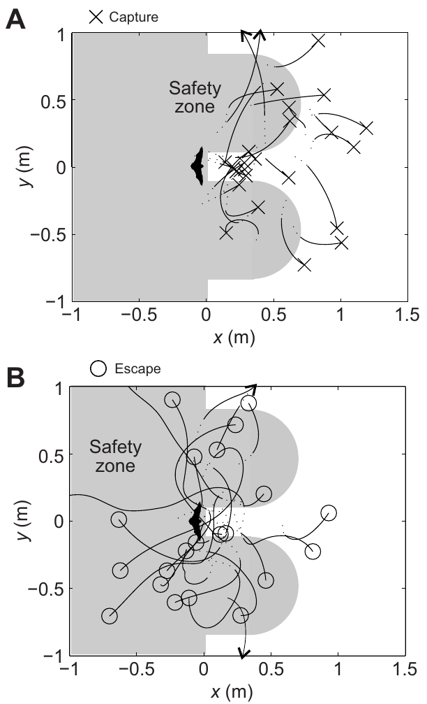
Successful trajectories reach the bat’s flanks
Escaping moths often moved into regions flanking the approaching bat rather than retreating along its existing pursuit axis. Corcoran and Conner compared reconstructed paths with the safety regions predicted by their geometrical model.
Their safety zone is a modeled region the bat cannot immediately intercept under assumptions about reaction delay, capture width and turning radius. Measured escape paths entered it more often than capture paths did.
The flight coordinates are empirical; the shaded regions and simplified boundaries are the authors’ model-derived interpretation. Agreement supports a geometrical explanation for the observed maneuvers without converting its assumptions into direct measurements. The result does not establish the moth’s internal representation of the zone or a fully identified steering circuit.
Corcoran & Conner (2016), Fig. 3(A–D). Measured three-dimensional evasive flight trajectories.
Corcoran & Conner (2016), Fig. 9(A–B). Measured paths relative to the authors’ modeled safety zones.
Corcoran & Conner (2016)
40
Notes:
• Escaping moths often moved into regions flanking the approaching bat rather than retreating along its existing pursuit axis. Corcoran and Conner compared reconstructed paths with the safety regions predicted by their geometrical model.
• Their **safety zone** is a modeled region the bat cannot immediately intercept under assumptions about reaction delay, capture width and turning radius. Measured escape paths entered it more often than capture paths did.
– Measured flight trajectories are evaluated against regions derived from the authors’ geometrical assumptions. A useful geometrical prediction can explain outcomes even when the animal’s decision mechanism remains unknown.
• The flight coordinates are empirical; the shaded regions and simplified boundaries are the authors’ model-derived interpretation. Agreement supports a geometrical explanation for the observed maneuvers without converting its assumptions into direct measurements. The result does not establish the moth’s internal representation of the zone or a fully identified steering circuit.
References:
Corcoran AJ, Conner WE (2016). How moths escape bats: predicting outcomes of predator-prey interactions. Journal of Experimental Biology 219: 2704–2715. https://doi.org/10.1242/jeb.137638
Figure: Corcoran & Conner (2016), Fig. 9(A–B). Measured paths relative to the authors’ modeled safety zones.
Figure source: https://doi.org/10.1242/jeb.137638
Figure: Corcoran & Conner (2016), Fig. 3(A–D). Measured three-dimensional evasive flight trajectories.
Figure source: https://doi.org/10.1242/jeb.137638

Slide 41
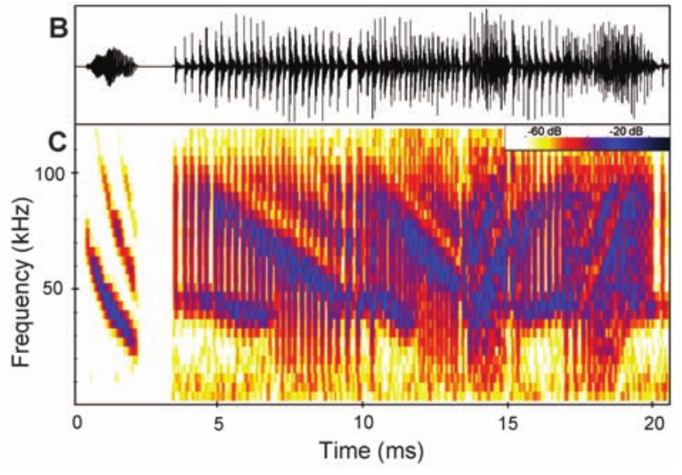
Tiger-moth tymbals produce overlapping ultrasonic clicks
Bertholdia trigona produces dense ultrasonic clicking in response to attacking bats. Its tymbal has a specialized surface associated with sound production, documented by scanning electron microscopy.
Corcoran and colleagues compared an example echo from a big brown bat, Eptesicus fuscus, with two overlapping moth click cycles. The published acoustic comparison uses signals at estimated levels reaching a bat 1 m from the moth.
The clicks occupy time and frequency ranges capable of interfering with returning echoes. Sonar jamming means disruption of the bat’s use of echoes for prey localization, rather than simply making the moth audible. Acoustic overlap supports a plausible interference mechanism, but the defense’s effectiveness requires behavioral tests of the predator.
Corcoran et al. (2009), Fig. 1(B–C). Published comparison of an example echo and moth clicks.
Corcoran et al. (2009), Fig. 1(A). Sound-producing tymbal; scale bar 1 mm.
Corcoran et al. (2009)
41
Notes:
• _Bertholdia trigona_ produces dense ultrasonic clicking in response to attacking bats. Its tymbal has a specialized surface associated with sound production, documented by scanning electron microscopy.
• Corcoran and colleagues compared an example echo from a big brown bat, _Eptesicus fuscus_, with two overlapping moth click cycles. The published acoustic comparison uses signals at estimated levels reaching a bat 1 m from the moth.
– The echo in the published comparison is a constructed example described by the source authors, whereas the click sequence comes from the moth’s sound production. That acoustic comparison alone does not prove jamming. The tymbal is the sound-output organ and should not be confused with the hearing membrane.
• The clicks occupy time and frequency ranges capable of interfering with returning echoes. **Sonar jamming** means disruption of the bat’s use of echoes for prey localization, rather than simply making the moth audible. Acoustic overlap supports a plausible interference mechanism, but the defense’s effectiveness requires behavioral tests of the predator.
References:
Corcoran AJ, Barber JR, Conner WE (2009). Tiger Moth Jams Bat Sonar. Science 325: 325-327. https://doi.org/10.1126/science.1174096
Figure: Corcoran et al. (2009), Fig. 1(B–C). Published comparison of an example echo and moth clicks.
Figure source: https://doi.org/10.1126/science.1174096
Figure: Corcoran et al. (2009), Fig. 1(A). Sound-producing tymbal; scale bar 1 mm.
Figure source: https://doi.org/10.1126/science.1174096

Slide 42
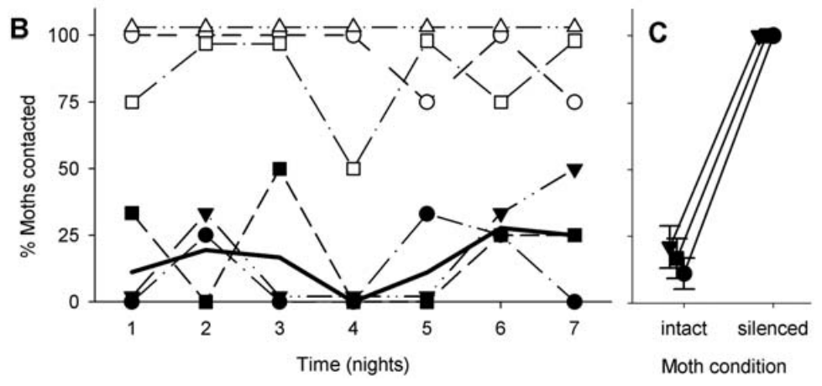
Silencing tymbals removes the protection from clicks
Corcoran and colleagues presented tethered moths to trained big brown bats in a flight room while recording attacks with infrared video and ultrasound. Silent palatable moths provided a comparison with clicking Bertholdia trigona.
Bats contacted the silent controls much more frequently than clicking moths. After the sound-producing tymbals were ablated, the bats contacted all presented B. trigona in that silenced condition. Ablation means physical removal of the tested structure.
The intervention links the intact acoustic defense to reduced attack success. It is stronger evidence than observing clicks near a missed capture alone. Tethering restricts evasive flight, and organ removal is a physical manipulation; the experiment establishes the importance of sound production in this preparation rather than every ecological benefit of the species.
Corcoran et al. (2009), Fig. 2(B–C). Observed contact rates and tymbal-silencing control.
Corcoran et al. (2009), Fig. 1(A). Sound-producing tymbal; scale bar 1 mm.
Corcoran et al. (2009)
42
Notes:
• Corcoran and colleagues presented tethered moths to trained big brown bats in a flight room while recording attacks with infrared video and ultrasound. Silent palatable moths provided a comparison with clicking _Bertholdia trigona_.
• Bats contacted the silent controls much more frequently than clicking moths. After the sound-producing tymbals were ablated, the bats contacted all presented _B. trigona_ in that silenced condition. **Ablation** means physical removal of the tested structure.
– The same moth species was tested with and without the ability to click, helping separate sound production from differences among prey species. Contact was the measured attack-success endpoint. It should not automatically be treated as identical to consumption or long-term survival.
• The intervention links the intact acoustic defense to reduced attack success. It is stronger evidence than observing clicks near a missed capture alone. Tethering restricts evasive flight, and organ removal is a physical manipulation; the experiment establishes the importance of sound production in this preparation rather than every ecological benefit of the species.
References:
Corcoran AJ, Barber JR, Conner WE (2009). Tiger Moth Jams Bat Sonar. Science 325: 325-327. https://doi.org/10.1126/science.1174096
Figure: Corcoran et al. (2009), Fig. 2(B–C). Observed contact rates and tymbal-silencing control.
Figure source: https://doi.org/10.1126/science.1174096
Figure: Corcoran et al. (2009), Fig. 1(A). Sound-producing tymbal; scale bar 1 mm.
Figure source: https://doi.org/10.1126/science.1174096

Slide 43
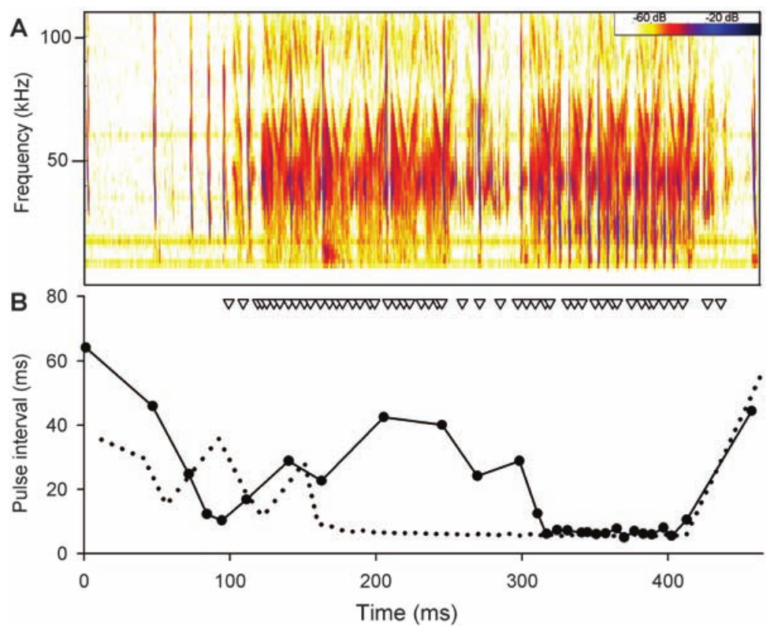
Persistent protection supports jamming over startle
A startle defense should weaken as a predator becomes accustomed to the sound, whereas a learned warning should change as the predator associates the signal with an unpleasant prey item. These alternatives predict different attack patterns over repeated experience.
In Corcoran and colleagues’ experiment, protection from Bertholdia trigona clicks appeared immediately and persisted over successive nights. Bats that ate the moths still had difficulty contacting clicking individuals, and attacks often continued after the sound began.
The pattern supports sonar interference over a purely transient startle effect or learned rejection of distasteful prey. Individual bats differed in palatability responses, so the strongest interpretation concerns those that consumed the moths. The experiment supports jamming without identifying one exclusive neural mechanism of echo disruption.
Corcoran et al. (2009), Fig. 2(B–C). Observed contact rates and tymbal-silencing control.
Corcoran et al. (2009), Fig. 3(A–B). Echolocation timing during an attack on a clicking moth.
Corcoran et al. (2009)
43
Notes:
• A startle defense should weaken as a predator becomes accustomed to the sound, whereas a learned warning should change as the predator associates the signal with an unpleasant prey item. These alternatives predict different attack patterns over repeated experience.
• In Corcoran and colleagues’ experiment, protection from _Bertholdia trigona_ clicks appeared immediately and persisted over successive nights. Bats that ate the moths still had difficulty contacting clicking individuals, and attacks often continued after the sound began.
– The investigators included juvenile bats without prior experience of clicking prey and an experienced adult. The persistence comparison is behavioral evidence, while palatability observations address the warning alternative. More than one defensive function can coexist, so the conclusion is not that moth clicks can never warn or startle.
• The pattern supports sonar interference over a purely transient startle effect or learned rejection of distasteful prey. Individual bats differed in palatability responses, so the strongest interpretation concerns those that consumed the moths. The experiment supports jamming without identifying one exclusive neural mechanism of echo disruption.
References:
Corcoran AJ, Barber JR, Conner WE (2009). Tiger Moth Jams Bat Sonar. Science 325: 325-327. https://doi.org/10.1126/science.1174096
Figure: Corcoran et al. (2009), Fig. 2(B–C). Observed contact rates and tymbal-silencing control.
Figure source: https://doi.org/10.1126/science.1174096
Figure: Corcoran et al. (2009), Fig. 3(A–B). Echolocation timing during an attack on a clicking moth.
Figure source: https://doi.org/10.1126/science.1174096

Slide 44
Moth clicks disrupt the progression of an attack
Big brown bats attacking silent control moths normally progressed through approach, tracking and terminal echolocation stages. Corcoran and colleagues recorded a different temporal pattern during some attacks on clicking Bertholdia trigona.
After moth clicks began, bats sometimes lengthened their pulse intervals and returned to an earlier attack stage before continuing pursuit. Such reversals occurred in roughly one third of the clicking-moth attacks and persisted with experience.
The acoustic record links interference with disrupted hunting progression rather than simple abandonment whenever a click is heard. It complements the tymbal-silencing and repeated-exposure controls. The study does not directly measure the bat’s perceived target distance or establish whether false echoes, masking or disrupted range processing contributes most to the failure.
Corcoran et al. (2009), Fig. 3(A–B). Echolocation timing during an attack on a clicking moth.
Corcoran et al. (2009)
44
Notes:
• Big brown bats attacking silent control moths normally progressed through approach, tracking and terminal echolocation stages. Corcoran and colleagues recorded a different temporal pattern during some attacks on clicking _Bertholdia trigona_.
• After moth clicks began, bats sometimes lengthened their pulse intervals and returned to an earlier attack stage before continuing pursuit. Such reversals occurred in roughly one third of the clicking-moth attacks and persisted with experience.
– The spectrogram records frequency against time, and the interval plot records the spacing between emitted bat calls. Moth click timing is retained separately. A change in call progression is an observed predator response, while the precise sensory confusion inside the bat remains inferred.
• The acoustic record links interference with disrupted hunting progression rather than simple abandonment whenever a click is heard. It complements the tymbal-silencing and repeated-exposure controls. The study does not directly measure the bat’s perceived target distance or establish whether false echoes, masking or disrupted range processing contributes most to the failure.
References:
Corcoran AJ, Barber JR, Conner WE (2009). Tiger Moth Jams Bat Sonar. Science 325: 325-327. https://doi.org/10.1126/science.1174096
Figure: Corcoran et al. (2009), Fig. 3(A–B). Echolocation timing during an attack on a clicking moth.
Figure source: https://doi.org/10.1126/science.1174096

Slide 45
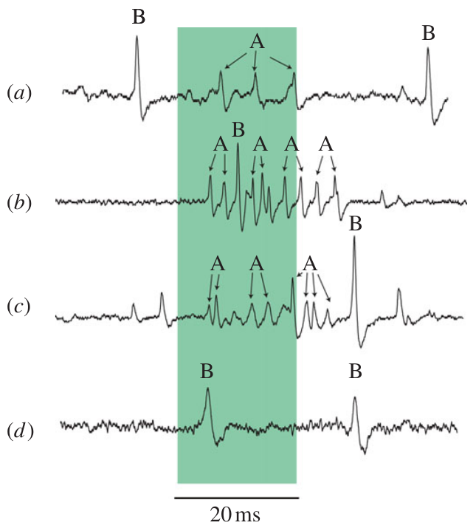
Hearing measurements constrain claims about escape
Sound reception, neural coding and defensive behavior are distinct experimental outcomes. Wax-moth recordings established spikes to 300-kHz stimulation, but did not establish evasive flight at that frequency.
In noctuid moths, a short-pulse A1 plateau established limited intensity coding through spike count despite a clear auditory response. A receptor can therefore register the presence of sound without continuously reporting every change in its amplitude.
Connecting those signals to behavior requires central recordings and interventions, as well as measurements of the actual escape or clicking response. Roeder’s pulse-marker observations and the later flight and tymbal experiments address different links in that chain. The measured findings support a sensory defense while leaving the full molecular and sensorimotor mechanism incompletely resolved.
Gordon & ter Hofstede (2018), Fig. 3(A). A1 saturation before A2 recruitment in Raphia frater.
Moir et al. (2013), Fig. 2(a–d). Auditory spikes at 80, 280 and 300 kHz.
Moir et al. (2013); Gordon & ter Hofstede (2018); Roeder (1966); Corcoran & Conner (2016); Corcoran et al. (2009)
45
Notes:
• Sound reception, neural coding and defensive behavior are distinct experimental outcomes. Wax-moth recordings established spikes to 300-kHz stimulation, but did not establish evasive flight at that frequency.
• In noctuid moths, a short-pulse A1 plateau established limited intensity coding through spike count despite a clear auditory response. A receptor can therefore register the presence of sound without continuously reporting every change in its amplitude.
– The wax-moth traces distinguish sound-associated A spikes from non-acoustic B spikes, including an example without an auditory response at the tested high frequency. The noctuid plateau is a separate limitation in a different preparation. Neither result should be generalized as a complete account of all moth hearing.
• Connecting those signals to behavior requires central recordings and interventions, as well as measurements of the actual escape or clicking response. Roeder’s pulse-marker observations and the later flight and tymbal experiments address different links in that chain. The measured findings support a sensory defense while leaving the full molecular and sensorimotor mechanism incompletely resolved.
References:
Moir HM, Jackson JC, Windmill JFC (2013). Extremely high frequency sensitivity in a ‘simple’ ear. Biology Letters 9: 20130241. https://doi.org/10.1098/rsbl.2013.0241
Gordon SD, ter Hofstede HM (2018). The influence of bat echolocation call duration and timing on auditory encoding of predator distance in noctuoid moths. Journal of Experimental Biology 221: jeb171561. https://doi.org/10.1242/jeb.171561
Roeder KD (1966). Interneurons of the thoracic nerve cord activated by tympanic nerve fibres in noctuid moths. Journal of Insect Physiology 12: 1227-1244. https://doi.org/10.1016/0022-1910(66)90014-x
Corcoran AJ, Conner WE (2016). How moths escape bats: predicting outcomes of predator-prey interactions. Journal of Experimental Biology 219: 2704–2715. https://doi.org/10.1242/jeb.137638
Corcoran AJ, Barber JR, Conner WE (2009). Tiger Moth Jams Bat Sonar. Science 325: 325-327. https://doi.org/10.1126/science.1174096
Figure: Moir et al. (2013), Fig. 2(a–d). Auditory spikes at 80, 280 and 300 kHz.
Figure source: https://doi.org/10.1098/rsbl.2013.0241
Figure: Gordon & ter Hofstede (2018), Fig. 3(A). A1 saturation before A2 recruitment in Raphia frater.
Figure source: https://doi.org/10.1242/jeb.171561

Slide 46
Key takeaways
Mechanical coupling: Tympanic displacement drives receptor excitation; in the measured noctuid preparation, A1 and A2 differ substantially in displacement threshold.
Range and timing: A1 is more sensitive than A2, but short calls can saturate A1 before A2 recruitment. Pulse duration and repetition influence the information reaching central neurons.
Central transformation: Repeaters preserve much of an afferent burst, whereas pulse-marker units select event timing. Their transmitters and complete causal escape circuit were not established by the extracellular recordings.
Escape geometry: Moths can survive faster bats through sharply timed turns and trajectories toward the predator’s flanks. Radial acceleration and escape angle predict outcomes better than speed alone.
Acoustic defense: Tiger-moth clicks can jam bat sonar. Sound-organ silencing and persistent protection across repeated attacks provide causal and comparative evidence for this defense.
Evidence limits: Hearing a sound, encoding its intensity and executing escape are different outcomes. A neural threshold or a model prediction alone does not prove the corresponding defensive behavior.
ter Hofstede et al. (2011); Gordon & ter Hofstede (2018); Roeder (1966); Corcoran & Conner (2016); Corcoran et al. (2009)
46
Notes:
References:
ter Hofstede HM, Goerlitz HR, Montealegre-Z F, Robert D, Holderied MW (2011). Tympanal mechanics and neural responses in the ears of a noctuid moth. Naturwissenschaften 98: 1057-1061. https://doi.org/10.1007/s00114-011-0851-7
Gordon SD, ter Hofstede HM (2018). The influence of bat echolocation call duration and timing on auditory encoding of predator distance in noctuoid moths. Journal of Experimental Biology 221: jeb171561. https://doi.org/10.1242/jeb.171561
Roeder KD (1966). Interneurons of the thoracic nerve cord activated by tympanic nerve fibres in noctuid moths. Journal of Insect Physiology 12: 1227-1244. https://doi.org/10.1016/0022-1910(66)90014-x
Corcoran AJ, Conner WE (2016). How moths escape bats: predicting outcomes of predator-prey interactions. Journal of Experimental Biology 219: 2704–2715. https://doi.org/10.1242/jeb.137638
Corcoran AJ, Barber JR, Conner WE (2009). Tiger Moth Jams Bat Sonar. Science 325: 325-327. https://doi.org/10.1126/science.1174096

