Slide 1
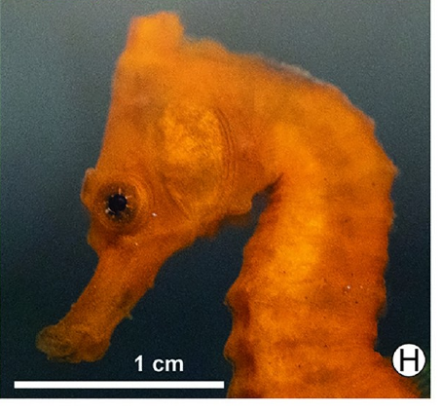
NEUR 411 · NEUROETHOLOGY · FALL 2026
Lecture 60
Seahorses:
brain organization, visual processing, sensorimeotor control of prey capture, courtship communication, and reproductive behavior
Date TBD
Jordan Lopez, Ph.D.
Professor of Neurobiology & Biomedical Engineering
Vaccani et al. (2019), Fig. 2H. Longsnout seahorse under natural white light.
Notes:
Seahorses: brain organization, visual processing, sensorimeotor control of prey capture, courtship communication, and reproductive behavior
Lecture 60. NEUR 411 · NEUROETHOLOGY · FALL 2026. Date TBD.
Figure: Vaccani et al. (2019), Fig. 2H. Longsnout seahorse under natural white light.
Figure source: https://doi.org/10.1371/journal.pone.0220561
References:
Amanda C. Vaccani, Natalie V. Freret-Meurer, Áthila A. Bertoncini, Luciano N. Santos (2019). Shining in the dark: First record of biofluorescence in the seahorse Hippocampus reidi. PLOS ONE 14: e0220561. https://doi.org/10.1371/journal.pone.0220561

Slide 2
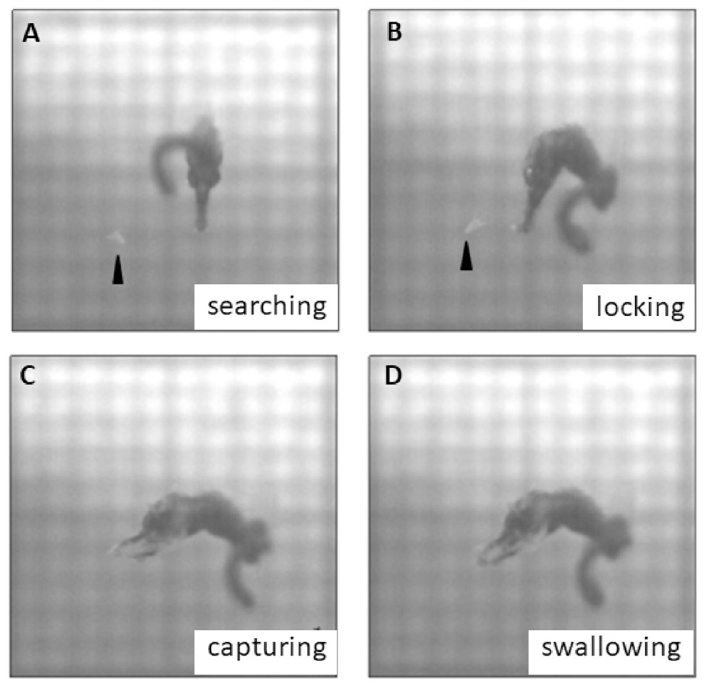
Newborn seahorses already capture live prey
Newborn lined seahorses, Hippocampus erectus, capture live Artemia, small crustaceans used as food, immediately after leaving the male. Their feeding behavior already combines visual search, target tracking, rapid head rotation, and ingestion. Feeding competence therefore begins before the feeding skeleton reaches its later degree of ossification.
Sun and colleagues recorded animals from 1 to 30 days after parturition, meaning birth. Newborns were about 9.2 mm tall and successfully captured prey in about 77% of feeding attempts under the study conditions.
Across development, body growth increased capture reach and food intake. Early independence depends on functional sensory and motor coordination together with continued maturation of the snout and digestive tract.
Sun et al. (2021), Fig. 1A–D. Searching, locking, capturing, and swallowing in a newborn.
Sun et al. (2021)
02
Notes:
• Newborn lined seahorses, Hippocampus erectus, capture live Artemia, small crustaceans used as food, immediately after leaving the male. Their feeding behavior already combines visual search, target tracking, rapid head rotation, and ingestion. Feeding competence therefore begins before the feeding skeleton reaches its later degree of ossification.
– The study combined high-speed recordings with histology of the eyes, snout, and intestine rather than inferring feeding ability from body size alone.
• Sun and colleagues recorded animals from 1 to 30 days after parturition, meaning birth. Newborns were about 9.2 mm tall and successfully captured prey in about 77% of feeding attempts under the study conditions.
• Across development, body growth increased capture reach and food intake. Early independence depends on functional sensory and motor coordination together with continued maturation of the snout and digestive tract.
References:
Jinhui Sun, Bo Zhang, Shangduan Xie, Honghao Zhao, Yanjing Yang, Pei Cui, Xiaohan Yu, Sudong Xia, Qiang Lin, Geng Qin (2021). Kinematics of prey capture and histological development of related organs in juvenile seahorse. Aquaculture 541: 736732. https://doi.org/10.1016/j.aquaculture.2021.736732
Figure: Sun et al. (2021), Fig. 1A–D. Searching, locking, capturing, and swallowing in a newborn.
Figure source: https://doi.org/10.1016/j.aquaculture.2021.736732

Slide 3
Prey capture combines four coordinated actions
Pivot feeding brings the mouth toward prey by rotating the head upward, followed by suction into the tubular snout. In newborn lined seahorses, this behavior formed a sequence of searching, locking, capturing, and swallowing. Each action changes the relationship between the animal and its target.
During searching, the eyes moved independently. During locking, the seahorse swam and turned to keep the prey ahead of its head. Capture began when the target entered the available capture distance, with head rotation and mouth opening taking less than 4 ms.
Swallowing restored the cranial and hyoid apparatus toward rest while ingested water and fragments exited through the gill opening. Fast acquisition and slower recovery are distinct components of the same feeding sequence.
Sun et al. (2021), Fig. 1A–D. Searching, locking, capturing, and swallowing in a newborn.
Sun et al. (2021)
03
Notes:
• Pivot feeding brings the mouth toward prey by rotating the head upward, followed by suction into the tubular snout. In newborn lined seahorses, this behavior formed a sequence of searching, locking, capturing, and swallowing. Each action changes the relationship between the animal and its target.
– The hyoid apparatus is the skeletal assembly beneath the mouth that participates in expansion and recovery during suction feeding.
• During searching, the eyes moved independently. During locking, the seahorse swam and turned to keep the prey ahead of its head. Capture began when the target entered the available capture distance, with head rotation and mouth opening taking less than 4 ms.
• Swallowing restored the cranial and hyoid apparatus toward rest while ingested water and fragments exited through the gill opening. Fast acquisition and slower recovery are distinct components of the same feeding sequence.
References:
Jinhui Sun, Bo Zhang, Shangduan Xie, Honghao Zhao, Yanjing Yang, Pei Cui, Xiaohan Yu, Sudong Xia, Qiang Lin, Geng Qin (2021). Kinematics of prey capture and histological development of related organs in juvenile seahorse. Aquaculture 541: 736732. https://doi.org/10.1016/j.aquaculture.2021.736732
Figure: Sun et al. (2021), Fig. 1A–D. Searching, locking, capturing, and swallowing in a newborn.
Figure source: https://doi.org/10.1016/j.aquaculture.2021.736732

Slide 4
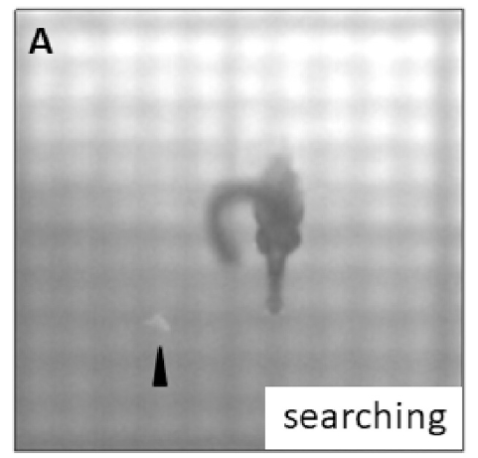
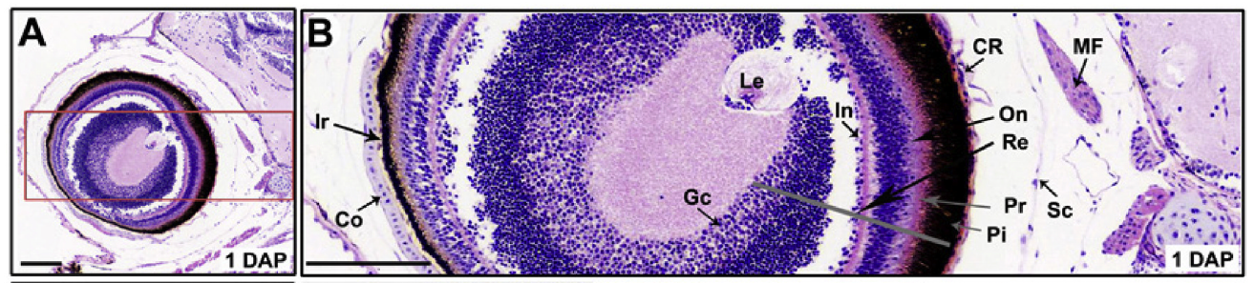
Independent eye movements precede target tracking
The two eyes of juvenile lined seahorses moved independently during prey search. After prey entered the visual field, the animal changed its swimming and turning so that the target remained in front of the head. These observations separate broad searching movements from target-directed tracking.
The newborn eye already contained an organized retina, the neural tissue that receives light. Rod and cone photoreceptors were present, together with a pigmented outer region and recognizable internal layers. The sensory tissue was therefore developed when independent feeding began.
Target tracking and the final strike operated on different time scales. Swimming maintained alignment before the brief capture movement, which could then bring the small terminal mouth to a nearby crustacean.
Sun et al. (2021), Fig. 1A. A newborn searches for Artemia.
Sun et al. (2021), Fig. 4A–B. Newborn eye and labeled retinal layers.
Sun et al. (2021)
04
Notes:
• The two eyes of juvenile lined seahorses moved independently during prey search. After prey entered the visual field, the animal changed its swimming and turning so that the target remained in front of the head. These observations separate broad searching movements from target-directed tracking.
– Sun and colleagues observed eye and body movements behaviorally; their recordings did not measure the activity of individual visual neurons.
• The newborn eye already contained an organized retina, the neural tissue that receives light. Rod and cone photoreceptors were present, together with a pigmented outer region and recognizable internal layers. The sensory tissue was therefore developed when independent feeding began.
• Target tracking and the final strike operated on different time scales. Swimming maintained alignment before the brief capture movement, which could then bring the small terminal mouth to a nearby crustacean.
References:
Jinhui Sun, Bo Zhang, Shangduan Xie, Honghao Zhao, Yanjing Yang, Pei Cui, Xiaohan Yu, Sudong Xia, Qiang Lin, Geng Qin (2021). Kinematics of prey capture and histological development of related organs in juvenile seahorse. Aquaculture 541: 736732. https://doi.org/10.1016/j.aquaculture.2021.736732
Figure: Sun et al. (2021), Fig. 1A. A newborn searches for Artemia.
Figure source: https://doi.org/10.1016/j.aquaculture.2021.736732
Figure: Sun et al. (2021), Fig. 4A–B. Newborn eye and labeled retinal layers.
Figure source: https://doi.org/10.1016/j.aquaculture.2021.736732

Slide 5
Photoreceptors are present at birth
Photoreceptors are retinal cells specialized to receive light. Histological sections of newborn lined seahorses contained both rods and cones between the pigment layer and the outer nuclear layer. The pigment layer and organized retinal tissue were already recognizable on the first day after birth.
Sun and colleagues used 4 µm tissue sections stained with hematoxylin and eosin. Their labeled sections distinguish photoreceptor tissue, nuclear layers, the ganglion-cell region, lens, and other ocular structures. This preparation describes tissue organization rather than directly measuring visual resolution.
The same newborn animals performed successful visual prey capture. Retinal differentiation and feeding competence therefore coexist at release, while later growth enlarges an already organized eye.
Sun et al. (2021), Fig. 4A–B. Newborn eye and labeled retinal layers.
Sun et al. (2021)
05
Notes:
• Photoreceptors are retinal cells specialized to receive light. Histological sections of newborn lined seahorses contained both rods and cones between the pigment layer and the outer nuclear layer. The pigment layer and organized retinal tissue were already recognizable on the first day after birth.
– Visual acuity means the ability to distinguish fine spatial detail; this study used histology and feeding observations rather than a behavioral acuity threshold.
• Sun and colleagues used 4 µm tissue sections stained with hematoxylin and eosin. Their labeled sections distinguish photoreceptor tissue, nuclear layers, the ganglion-cell region, lens, and other ocular structures. This preparation describes tissue organization rather than directly measuring visual resolution.
• The same newborn animals performed successful visual prey capture. Retinal differentiation and feeding competence therefore coexist at release, while later growth enlarges an already organized eye.
References:
Jinhui Sun, Bo Zhang, Shangduan Xie, Honghao Zhao, Yanjing Yang, Pei Cui, Xiaohan Yu, Sudong Xia, Qiang Lin, Geng Qin (2021). Kinematics of prey capture and histological development of related organs in juvenile seahorse. Aquaculture 541: 736732. https://doi.org/10.1016/j.aquaculture.2021.736732
Figure: Sun et al. (2021), Fig. 4A–B. Newborn eye and labeled retinal layers.
Figure source: https://doi.org/10.1016/j.aquaculture.2021.736732

Slide 6
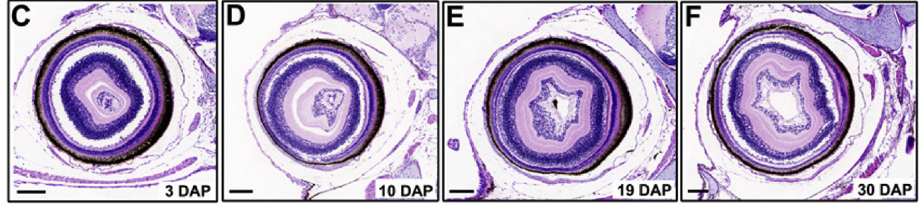
Eye growth preserves the early retinal organization
From 3 to 30 days after birth, juvenile lined seahorse eyes increased in diameter as the animals grew. Sun and colleagues reported no major rearrangement of the retinal histology during this period. Growth enlarged the organ while preserving its recognizable internal organization.
The retina was therefore unlike a sensory system that acquires its basic tissue layers only after feeding begins. At birth, the animal already combined an organized eye with successful capture; later increases in capture performance occurred while the existing retinal architecture remained recognizable.
Feeding development involved several tissues at once. Eye enlargement accompanied snout growth, increasing attack distance, and maturation of the digestive tract, so behavioral improvement belonged to the developing animal as a whole.
Sun et al. (2021), Fig. 4C–F. Eye growth from 3 to 30 days after birth.
Sun et al. (2021)
06
Notes:
• From 3 to 30 days after birth, juvenile lined seahorse eyes increased in diameter as the animals grew. Sun and colleagues reported no major rearrangement of the retinal histology during this period. Growth enlarged the organ while preserving its recognizable internal organization.
– The histological comparison included newborns and animals at several postnatal ages, with the latest illustrated eye sections taken at 30 days.
• The retina was therefore unlike a sensory system that acquires its basic tissue layers only after feeding begins. At birth, the animal already combined an organized eye with successful capture; later increases in capture performance occurred while the existing retinal architecture remained recognizable.
• Feeding development involved several tissues at once. Eye enlargement accompanied snout growth, increasing attack distance, and maturation of the digestive tract, so behavioral improvement belonged to the developing animal as a whole.
References:
Jinhui Sun, Bo Zhang, Shangduan Xie, Honghao Zhao, Yanjing Yang, Pei Cui, Xiaohan Yu, Sudong Xia, Qiang Lin, Geng Qin (2021). Kinematics of prey capture and histological development of related organs in juvenile seahorse. Aquaculture 541: 736732. https://doi.org/10.1016/j.aquaculture.2021.736732
Figure: Sun et al. (2021), Fig. 4C–F. Eye growth from 3 to 30 days after birth.
Figure source: https://doi.org/10.1016/j.aquaculture.2021.736732

Slide 7
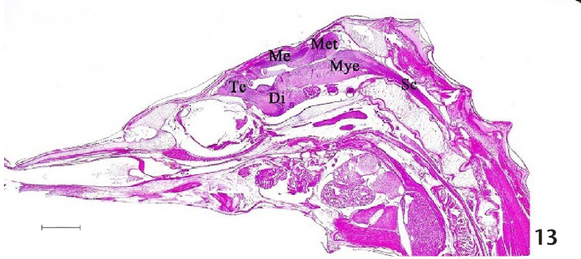
The seahorse brain retains five major divisions
The brain of Hippocampus barbouri contains the telencephalon, forebrain tissue including the cerebral hemispheres; the diencephalon; the mesencephalon or midbrain; the metencephalon; and the myelencephalon. Senarat and colleagues identified these divisions in sagittal histological sections, which cut along the head-to-tail axis.
The diencephalon contains the hypothalamus, while the midbrain contains the optic tectum. The metencephalon includes the cerebellum, and the myelencephalon includes the medulla, which continues toward the spinal cord. The unusual external body shape therefore accompanies a recognizable teleost brain arrangement.
The study compared tissue organization from 1 to 35 days after birth. Early sections were compact, whereas later sections distinguished the regional and cellular features of these divisions.
Senarat et al. (2020), Fig. 13. Sagittal brain histology with the five major divisions.
Senarat et al. (2020)
07
Notes:
• The brain of Hippocampus barbouri contains the telencephalon, forebrain tissue including the cerebral hemispheres; the diencephalon; the mesencephalon or midbrain; the metencephalon; and the myelencephalon. Senarat and colleagues identified these divisions in sagittal histological sections, which cut along the head-to-tail axis.
– Teleosts are the major group of ray-finned bony fishes; the named divisions describe anatomical regions rather than individual behavioral modules.
• The diencephalon contains the hypothalamus, while the midbrain contains the optic tectum. The metencephalon includes the cerebellum, and the myelencephalon includes the medulla, which continues toward the spinal cord. The unusual external body shape therefore accompanies a recognizable teleost brain arrangement.
• The study compared tissue organization from 1 to 35 days after birth. Early sections were compact, whereas later sections distinguished the regional and cellular features of these divisions.
References:
Sinlapachai Senarat, Jes Kettratad, Gen Kaneko, Thatpon Kamnurdnin, Chanyut Sudtongkong (2020). The microanatomy of the central nervous system and brain of the Indo-Pacific seahorse, Hippocampus barbouri, during development. Zoologia 37: e53734, 1–11. https://doi.org/10.3897/zoologia.37.e53734
Figure: Senarat et al. (2020), Fig. 13. Sagittal brain histology with the five major divisions.
Figure source: https://doi.org/10.3897/zoologia.37.e53734

Slide 8
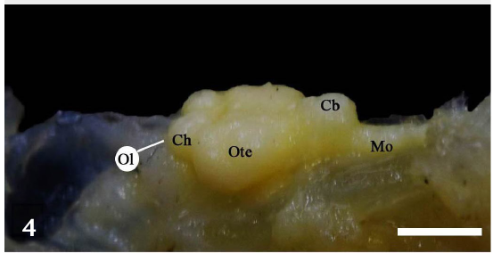
The optic tectum is a prominent brain region
The optic tectum, a midbrain region associated with visual orientation and multisensory processing in fishes, was the most prominent gross brain region in the examined Hippocampus barbouri. It lay between the anterior cerebral hemispheres and the posterior cerebellum.
Senarat and colleagues combined dissections, photographs, measurements, and stained tissue sections. In their 35-day animals, the tectum measured about 1,220 µm in length, compared with a cerebellar length of about 714 µm. These measurements describe regional anatomy in that developmental sample.
The authors proposed that the prominent tectum relates to visually guided feeding on mobile prey. This is an anatomical hypothesis connecting brain organization to behavior, rather than a recorded seahorse visual-neuron response.
Senarat et al. (2020), Fig. 4. Gross brain anatomy with a prominent optic tectum.
Senarat et al. (2020), Fig. 13. Sagittal brain histology with the five major divisions.
Senarat et al. (2020)
08
Notes:
• The optic tectum, a midbrain region associated with visual orientation and multisensory processing in fishes, was the most prominent gross brain region in the examined Hippocampus barbouri. It lay between the anterior cerebral hemispheres and the posterior cerebellum.
– The dissection and histological preparations provide complementary views: external position and internal tissue organization.
• Senarat and colleagues combined dissections, photographs, measurements, and stained tissue sections. In their 35-day animals, the tectum measured about 1,220 µm in length, compared with a cerebellar length of about 714 µm. These measurements describe regional anatomy in that developmental sample.
• The authors proposed that the prominent tectum relates to visually guided feeding on mobile prey. This is an anatomical hypothesis connecting brain organization to behavior, rather than a recorded seahorse visual-neuron response.
References:
Sinlapachai Senarat, Jes Kettratad, Gen Kaneko, Thatpon Kamnurdnin, Chanyut Sudtongkong (2020). The microanatomy of the central nervous system and brain of the Indo-Pacific seahorse, Hippocampus barbouri, during development. Zoologia 37: e53734, 1–11. https://doi.org/10.3897/zoologia.37.e53734
Figure: Senarat et al. (2020), Fig. 4. Gross brain anatomy with a prominent optic tectum.
Figure source: https://doi.org/10.3897/zoologia.37.e53734
Figure: Senarat et al. (2020), Fig. 13. Sagittal brain histology with the five major divisions.
Figure source: https://doi.org/10.3897/zoologia.37.e53734

Slide 9
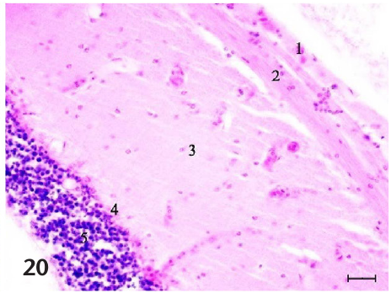
The tectum contains five histological layers
Laminar organization means that neural tissue is arranged in layers with different cellular and fiber composition. Senarat and colleagues recognized five layers in the seahorse optic tectum: stratum marginale, stratum opticum, stratum album centrale, stratum griseum centrale, and stratum periventriculare.
These layers extend from the outer tectal surface toward the ventricular region. Their differences in neuronal density and fiber organization divide the tissue into distinct anatomical compartments. The published micrographs preserve this organization at a scale of tens of micrometers.
The five-layer pattern was clear by 35 days after birth. Earlier tissue was less differentiated, so the layered tectum emerged during postnatal brain development while the animal continued growing.
Senarat et al. (2020), Fig. 20. Five histologically identified tectal layers.
Senarat et al. (2020)
09
Notes:
• Laminar organization means that neural tissue is arranged in layers with different cellular and fiber composition. Senarat and colleagues recognized five layers in the seahorse optic tectum: stratum marginale, stratum opticum, stratum album centrale, stratum griseum centrale, and stratum periventriculare.
– The layer names describe marginal, optic, central white, central gray, and periventricular tissue; no seahorse synaptic connection map was measured in this study.
• These layers extend from the outer tectal surface toward the ventricular region. Their differences in neuronal density and fiber organization divide the tissue into distinct anatomical compartments. The published micrographs preserve this organization at a scale of tens of micrometers.
• The five-layer pattern was clear by 35 days after birth. Earlier tissue was less differentiated, so the layered tectum emerged during postnatal brain development while the animal continued growing.
References:
Sinlapachai Senarat, Jes Kettratad, Gen Kaneko, Thatpon Kamnurdnin, Chanyut Sudtongkong (2020). The microanatomy of the central nervous system and brain of the Indo-Pacific seahorse, Hippocampus barbouri, during development. Zoologia 37: e53734, 1–11. https://doi.org/10.3897/zoologia.37.e53734
Figure: Senarat et al. (2020), Fig. 20. Five histologically identified tectal layers.
Figure source: https://doi.org/10.3897/zoologia.37.e53734

Slide 10
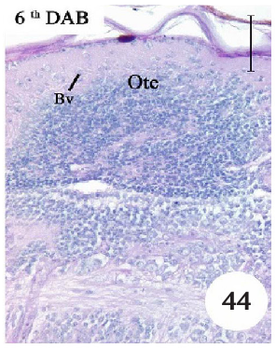
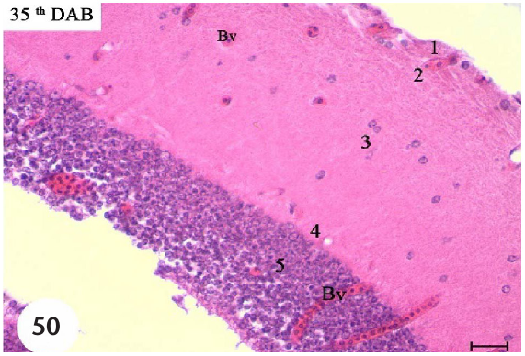
Tectal vascularization increases during development
Capillaries are small blood vessels supplying tissues. In Hippocampus barbouri, tectal capillaries became more apparent at 6 days after birth, and small vessels were conspicuous by 14 days. At 35 days, the tectum was highly vascularized and its five layers were distinguishable.
Senarat and colleagues followed these changes in stained sections. Vascular development occurred together with regional differentiation, linking the growth of neural tissue to the organization of its blood supply. The two features progressed within the same developmental sequence.
The authors hypothesized that increasing brain differentiation supports developing predatory ability. The age-dependent vascular and tissue changes provide an anatomical description of maturation, while prey-capture timing requires the separate behavioral evidence.
Senarat et al. (2020), Fig. 44. Tectal capillaries at 6 days after birth.
Senarat et al. (2020), Fig. 50. Vascularized tectum with five layers at 35 days.
Senarat et al. (2020)
10
Notes:
• Capillaries are small blood vessels supplying tissues. In Hippocampus barbouri, tectal capillaries became more apparent at 6 days after birth, and small vessels were conspicuous by 14 days. At 35 days, the tectum was highly vascularized and its five layers were distinguishable.
– The youngest brain sections were densely packed and lacked the clear substructures that were visible in later animals.
• Senarat and colleagues followed these changes in stained sections. Vascular development occurred together with regional differentiation, linking the growth of neural tissue to the organization of its blood supply. The two features progressed within the same developmental sequence.
• The authors hypothesized that increasing brain differentiation supports developing predatory ability. The age-dependent vascular and tissue changes provide an anatomical description of maturation, while prey-capture timing requires the separate behavioral evidence.
References:
Sinlapachai Senarat, Jes Kettratad, Gen Kaneko, Thatpon Kamnurdnin, Chanyut Sudtongkong (2020). The microanatomy of the central nervous system and brain of the Indo-Pacific seahorse, Hippocampus barbouri, during development. Zoologia 37: e53734, 1–11. https://doi.org/10.3897/zoologia.37.e53734
Figure: Senarat et al. (2020), Fig. 44. Tectal capillaries at 6 days after birth.
Figure source: https://doi.org/10.3897/zoologia.37.e53734
Figure: Senarat et al. (2020), Fig. 50. Vascularized tectum with five layers at 35 days.
Figure source: https://doi.org/10.3897/zoologia.37.e53734

Slide 11
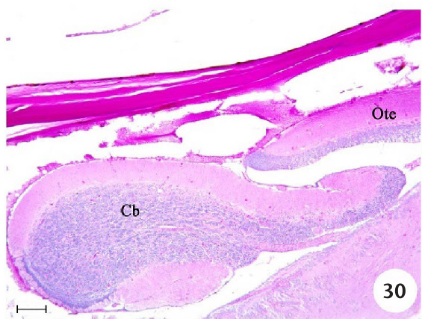
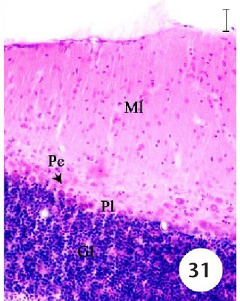
The cerebellum has three distinct cellular layers
The cerebellum lies behind the optic tectum in the seahorse brain. In 35-day Hippocampus barbouri, it contained an outer molecular layer, a Purkinje-cell layer, and an inner granular layer. This organization separates dendritic tissue from identifiable neuronal populations.
The molecular layer contained many dendritic fibers. Dendrites are neuronal processes that receive synaptic input. Synapses are junctions through which neurons communicate. The middle layer contained conspicuous Purkinje cells, while the granular layer contained densely arranged smaller principal neurons. Senarat and colleagues identified these regions using light microscopy.
Cerebellar differentiation continued after birth rather than appearing fully mature in the youngest animals. Increasing prominence of Purkinje cells and their dendrites accompanied the emergence of the layered tissue organization.
Senarat et al. (2020), Fig. 30. Cerebellum behind the optic tectum.
Senarat et al. (2020), Fig. 31. Molecular, Purkinje-cell, and granular cerebellar layers.
Senarat et al. (2020)
11
Notes:
• The cerebellum lies behind the optic tectum in the seahorse brain. In 35-day Hippocampus barbouri, it contained an outer molecular layer, a Purkinje-cell layer, and an inner granular layer. This organization separates dendritic tissue from identifiable neuronal populations.
– The study documents cerebellar anatomy; it did not record cerebellar firing during eye movements or feeding.
• The molecular layer contained many dendritic fibers. Dendrites are neuronal processes that receive synaptic input. Synapses are junctions through which neurons communicate. The middle layer contained conspicuous Purkinje cells, while the granular layer contained densely arranged smaller principal neurons. Senarat and colleagues identified these regions using light microscopy.
• Cerebellar differentiation continued after birth rather than appearing fully mature in the youngest animals. Increasing prominence of Purkinje cells and their dendrites accompanied the emergence of the layered tissue organization.
References:
Sinlapachai Senarat, Jes Kettratad, Gen Kaneko, Thatpon Kamnurdnin, Chanyut Sudtongkong (2020). The microanatomy of the central nervous system and brain of the Indo-Pacific seahorse, Hippocampus barbouri, during development. Zoologia 37: e53734, 1–11. https://doi.org/10.3897/zoologia.37.e53734
Figure: Senarat et al. (2020), Fig. 30. Cerebellum behind the optic tectum.
Figure source: https://doi.org/10.3897/zoologia.37.e53734
Figure: Senarat et al. (2020), Fig. 31. Molecular, Purkinje-cell, and granular cerebellar layers.
Figure source: https://doi.org/10.3897/zoologia.37.e53734

Slide 12
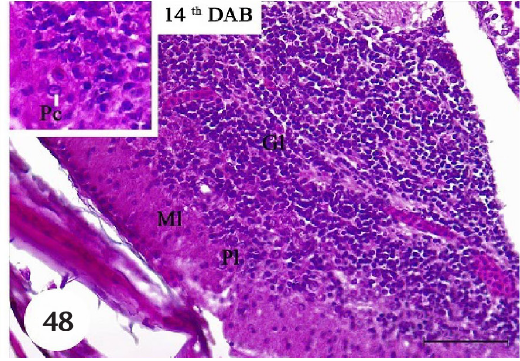
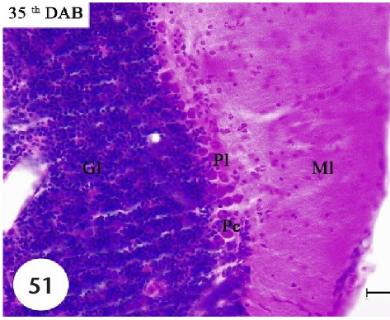
Purkinje cells become conspicuous after birth
Purkinje cells are the large neurons occupying the middle layer of the cerebellar cortex. They were difficult to identify in the earliest Hippocampus barbouri sections, became apparent by 14 days after birth, and were prominent by 35 days.
The later cells possessed dendrites extending into the molecular layer, where the study described abundant dendritic fibers. Development therefore involved the emergence of recognizable neuronal shape as well as separation of the three cerebellar layers.
This cellular sequence occurred while tectal layers and blood vessels also became more distinct. Different neural regions matured over overlapping postnatal intervals, producing a more differentiated brain rather than a single abrupt anatomical transition.
Senarat et al. (2020), Fig. 48. Developing cerebellar Purkinje cells at 14 days.
Senarat et al. (2020), Fig. 51. Cerebellar Purkinje cells at 35 days.
Senarat et al. (2020)
12
Notes:
• Purkinje cells are the large neurons occupying the middle layer of the cerebellar cortex. They were difficult to identify in the earliest Hippocampus barbouri sections, became apparent by 14 days after birth, and were prominent by 35 days.
– The 14-day and 35-day sections distinguish increasing cellular prominence within the same named cerebellar layers.
• The later cells possessed dendrites extending into the molecular layer, where the study described abundant dendritic fibers. Development therefore involved the emergence of recognizable neuronal shape as well as separation of the three cerebellar layers.
• This cellular sequence occurred while tectal layers and blood vessels also became more distinct. Different neural regions matured over overlapping postnatal intervals, producing a more differentiated brain rather than a single abrupt anatomical transition.
References:
Sinlapachai Senarat, Jes Kettratad, Gen Kaneko, Thatpon Kamnurdnin, Chanyut Sudtongkong (2020). The microanatomy of the central nervous system and brain of the Indo-Pacific seahorse, Hippocampus barbouri, during development. Zoologia 37: e53734, 1–11. https://doi.org/10.3897/zoologia.37.e53734
Figure: Senarat et al. (2020), Fig. 48. Developing cerebellar Purkinje cells at 14 days.
Figure source: https://doi.org/10.3897/zoologia.37.e53734
Figure: Senarat et al. (2020), Fig. 51. Cerebellar Purkinje cells at 35 days.
Figure source: https://doi.org/10.3897/zoologia.37.e53734

Slide 13
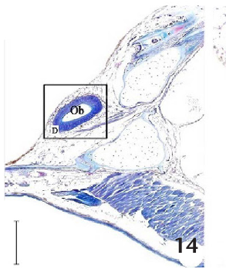
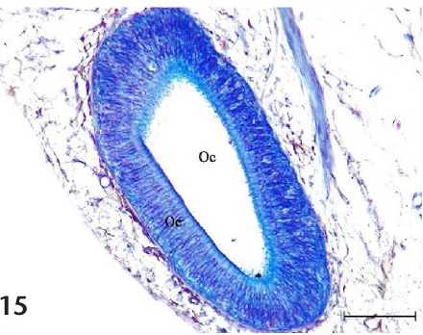
Olfactory tissue occupies the anterior snout
Olfactory epithelium is sensory tissue associated with chemical detection. In Hippocampus barbouri, Senarat and colleagues identified olfactory tissue in the anterior snout, surrounding a cavity and containing ciliated sensory cells. The cilia were conspicuous in the higher-magnification sections.
The olfactory tract connected the anterior olfactory region with the forebrain. A tract is a bundle of nerve fibers linking regions. Gross and histological preparations therefore located both the peripheral sensory tissue and its connection toward the cerebral hemispheres.
Vision dominates the published prey-tracking observations, but the seahorse head also contains a distinct chemical-sensory apparatus. These sensory structures occupy different anatomical locations and can contribute different kinds of information during interactions with the environment.
Senarat et al. (2020), Fig. 14. Olfactory tissue in the snout.
Senarat et al. (2020), Fig. 15. Olfactory epithelium with ciliated sensory cells.
Senarat et al. (2020)
13
Notes:
• Olfactory epithelium is sensory tissue associated with chemical detection. In Hippocampus barbouri, Senarat and colleagues identified olfactory tissue in the anterior snout, surrounding a cavity and containing ciliated sensory cells. The cilia were conspicuous in the higher-magnification sections.
– The published captions use olfactory-bulb terminology for some anterior tissue; the ciliated sensory epithelium is identified explicitly in the higher-magnification panel.
• The olfactory tract connected the anterior olfactory region with the forebrain. A tract is a bundle of nerve fibers linking regions. Gross and histological preparations therefore located both the peripheral sensory tissue and its connection toward the cerebral hemispheres.
• Vision dominates the published prey-tracking observations, but the seahorse head also contains a distinct chemical-sensory apparatus. These sensory structures occupy different anatomical locations and can contribute different kinds of information during interactions with the environment.
References:
Sinlapachai Senarat, Jes Kettratad, Gen Kaneko, Thatpon Kamnurdnin, Chanyut Sudtongkong (2020). The microanatomy of the central nervous system and brain of the Indo-Pacific seahorse, Hippocampus barbouri, during development. Zoologia 37: e53734, 1–11. https://doi.org/10.3897/zoologia.37.e53734
Figure: Senarat et al. (2020), Fig. 14. Olfactory tissue in the snout.
Figure source: https://doi.org/10.3897/zoologia.37.e53734
Figure: Senarat et al. (2020), Fig. 15. Olfactory epithelium with ciliated sensory cells.
Figure source: https://doi.org/10.3897/zoologia.37.e53734

Slide 14
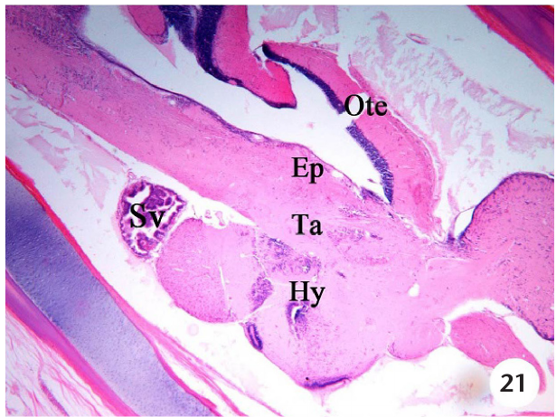
The diencephalon includes endocrine-associated tissue
The diencephalon lies beneath the midbrain and contains the epithalamus, thalamus, and hypothalamus. Senarat and colleagues distinguished these regions in stained Hippocampus barbouri sections. The hypothalamus was the dominant portion of this division in their anatomical description.
The three diencephalic regions occupied distinct positions beneath the midbrain. The thalamus lay between the epithalamus and hypothalamus and contained neuronal cell bodies, supporting glial cells, and nerve fibers. Glial cells are non-neuronal cells that support neural tissue; they were recognizable alongside neurons in several brain regions.
The hypothalamus contained neurosecretory cell populations and was anatomically associated with the pituitary. This regional arrangement places hormone-related tissue within the same brain that contains the visual and motor-associated structures.
Senarat et al. (2020), Fig. 21. Epithalamus, thalamus, and hypothalamus.
Senarat et al. (2020)
14
Notes:
• The diencephalon lies beneath the midbrain and contains the epithalamus, thalamus, and hypothalamus. Senarat and colleagues distinguished these regions in stained Hippocampus barbouri sections. The hypothalamus was the dominant portion of this division in their anatomical description.
– The hypothalamic relationship with the pituitary supplies anatomical context for the later seahorse peptide-administration experiments.
• The three diencephalic regions occupied distinct positions beneath the midbrain. The thalamus lay between the epithalamus and hypothalamus and contained neuronal cell bodies, supporting glial cells, and nerve fibers. Glial cells are non-neuronal cells that support neural tissue; they were recognizable alongside neurons in several brain regions.
• The hypothalamus contained neurosecretory cell populations and was anatomically associated with the pituitary. This regional arrangement places hormone-related tissue within the same brain that contains the visual and motor-associated structures.
References:
Sinlapachai Senarat, Jes Kettratad, Gen Kaneko, Thatpon Kamnurdnin, Chanyut Sudtongkong (2020). The microanatomy of the central nervous system and brain of the Indo-Pacific seahorse, Hippocampus barbouri, during development. Zoologia 37: e53734, 1–11. https://doi.org/10.3897/zoologia.37.e53734
Figure: Senarat et al. (2020), Fig. 21. Epithalamus, thalamus, and hypothalamus.
Figure source: https://doi.org/10.3897/zoologia.37.e53734

Slide 15
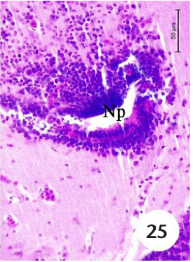
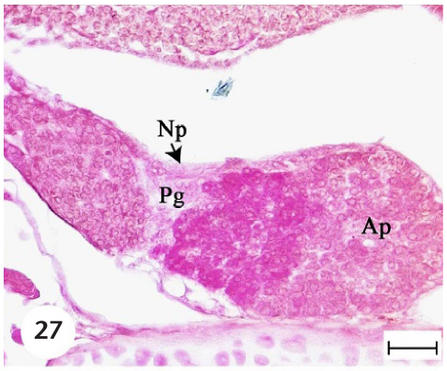
Hypothalamic and pituitary tissues are differentiated
Neurosecretory cells are neural cells specialized to produce secreted signaling molecules. Senarat and colleagues described such cell populations in the seahorse hypothalamus, including periventricular and lateral tuberal regions. These locations differed from the layered optic tectum and cerebellum.
The pituitary contained a neural region, the neurohypophysis, and a glandular region, the adenohypophysis. Histological sections distinguished their tissue organization, providing an anatomical basis for separating neural hormone-associated tissue from glandular endocrine tissue.
During development, pituitary glandular tissue became conspicuous by 14 days after birth. Neural, vascular, and endocrine-associated structures therefore differentiated over overlapping intervals, while later reproductive experiments examined how peptide signals altered pituitary gene expression.
Senarat et al. (2020), Fig. 25. Periventricular hypothalamic cell population.
Senarat et al. (2020), Fig. 27. Neural and glandular regions of the pituitary.
Senarat et al. (2020)
15
Notes:
• Neurosecretory cells are neural cells specialized to produce secreted signaling molecules. Senarat and colleagues described such cell populations in the seahorse hypothalamus, including periventricular and lateral tuberal regions. These locations differed from the layered optic tectum and cerebellum.
– The source uses an inconsistent spelling for the glandular pituitary region; adenohypophysis is the standard anatomical term.
• The pituitary contained a neural region, the neurohypophysis, and a glandular region, the adenohypophysis. Histological sections distinguished their tissue organization, providing an anatomical basis for separating neural hormone-associated tissue from glandular endocrine tissue.
• During development, pituitary glandular tissue became conspicuous by 14 days after birth. Neural, vascular, and endocrine-associated structures therefore differentiated over overlapping intervals, while later reproductive experiments examined how peptide signals altered pituitary gene expression.
References:
Sinlapachai Senarat, Jes Kettratad, Gen Kaneko, Thatpon Kamnurdnin, Chanyut Sudtongkong (2020). The microanatomy of the central nervous system and brain of the Indo-Pacific seahorse, Hippocampus barbouri, during development. Zoologia 37: e53734, 1–11. https://doi.org/10.3897/zoologia.37.e53734
Figure: Senarat et al. (2020), Fig. 25. Periventricular hypothalamic cell population.
Figure source: https://doi.org/10.3897/zoologia.37.e53734
Figure: Senarat et al. (2020), Fig. 27. Neural and glandular regions of the pituitary.
Figure source: https://doi.org/10.3897/zoologia.37.e53734

Slide 16
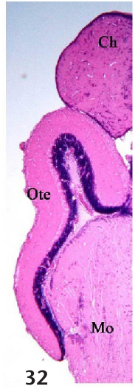
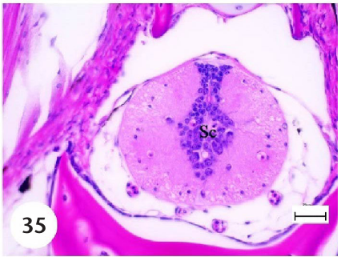
The hindbrain continues into the spinal cord
The medulla oblongata is the posterior brain region that continues toward the spinal cord. In Hippocampus barbouri, the medulla contained neurons and glial cells, with the fourth ventricle bordering part of the tissue. Senarat and colleagues followed this continuity in sagittal sections.
The spinal cord extended through the vertebral column. Cross-sections contained central neural tissue and a central canal, the fluid-containing channel continuous with the brain ventricles. The canal boundary included ependymal cells, which line these internal fluid spaces.
The brain and spinal cord form a continuous central nervous system. Within spinal tissue, neurons and glial cells occupied the region surrounding the central canal, extending cellular organization along the brain-to-body axis.
Senarat et al. (2020), Fig. 32. Sagittal brain section extending into the medulla.
Senarat et al. (2020), Fig. 35. Spinal cord cross-section and central canal.
Senarat et al. (2020)
16
Notes:
• The medulla oblongata is the posterior brain region that continues toward the spinal cord. In Hippocampus barbouri, the medulla contained neurons and glial cells, with the fourth ventricle bordering part of the tissue. Senarat and colleagues followed this continuity in sagittal sections.
– The micrographs identify the central canal and surrounding tissue directly; locomotor responses were not tested by lesions or neural recording.
• The spinal cord extended through the vertebral column. Cross-sections contained central neural tissue and a central canal, the fluid-containing channel continuous with the brain ventricles. The canal boundary included ependymal cells, which line these internal fluid spaces.
• The brain and spinal cord form a continuous central nervous system. Within spinal tissue, neurons and glial cells occupied the region surrounding the central canal, extending cellular organization along the brain-to-body axis.
References:
Sinlapachai Senarat, Jes Kettratad, Gen Kaneko, Thatpon Kamnurdnin, Chanyut Sudtongkong (2020). The microanatomy of the central nervous system and brain of the Indo-Pacific seahorse, Hippocampus barbouri, during development. Zoologia 37: e53734, 1–11. https://doi.org/10.3897/zoologia.37.e53734
Figure: Senarat et al. (2020), Fig. 32. Sagittal brain section extending into the medulla.
Figure source: https://doi.org/10.3897/zoologia.37.e53734
Figure: Senarat et al. (2020), Fig. 35. Spinal cord cross-section and central canal.
Figure source: https://doi.org/10.3897/zoologia.37.e53734

Slide 17
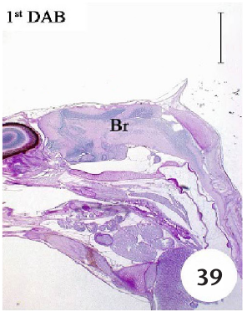
Neural maturation and feeding competence differ
Newborn Hippocampus barbouri brains appeared compact, with relatively indistinct substructures, in Senarat and colleagues’ sections. By contrast, Sun and colleagues observed organized retinas and successful prey capture on the first day after birth in lined seahorses, Hippocampus erectus.
These findings concern different species and different measurements. Behavioral competence means successful performance of an action, whereas histological differentiation describes the visibility and organization of tissue features. A functional behavior can occur while anatomical maturation continues.
The brain study’s proposed onset of predatory development at 6–14 days is therefore a species-specific anatomical hypothesis. Direct newborn feeding observations establish early competence in the lined seahorse and identify continued development as improvement of an existing behavior.
Senarat et al. (2020), Fig. 39. Compact brain organization at 1 day after birth.
Sun et al. (2021), Fig. 4A–B. Newborn eye and labeled retinal layers.
Senarat et al. (2020); Sun et al. (2021)
17
Notes:
• Newborn Hippocampus barbouri brains appeared compact, with relatively indistinct substructures, in Senarat and colleagues’ sections. By contrast, Sun and colleagues observed organized retinas and successful prey capture on the first day after birth in lined seahorses, Hippocampus erectus.
– The species difference changes the conclusion: the histological timetable should not be presented as a universal onset of seahorse feeding.
• These findings concern different species and different measurements. Behavioral competence means successful performance of an action, whereas histological differentiation describes the visibility and organization of tissue features. A functional behavior can occur while anatomical maturation continues.
• The brain study’s proposed onset of predatory development at 6–14 days is therefore a species-specific anatomical hypothesis. Direct newborn feeding observations establish early competence in the lined seahorse and identify continued development as improvement of an existing behavior.
References:
Sinlapachai Senarat, Jes Kettratad, Gen Kaneko, Thatpon Kamnurdnin, Chanyut Sudtongkong (2020). The microanatomy of the central nervous system and brain of the Indo-Pacific seahorse, Hippocampus barbouri, during development. Zoologia 37: e53734, 1–11. https://doi.org/10.3897/zoologia.37.e53734
Jinhui Sun, Bo Zhang, Shangduan Xie, Honghao Zhao, Yanjing Yang, Pei Cui, Xiaohan Yu, Sudong Xia, Qiang Lin, Geng Qin (2021). Kinematics of prey capture and histological development of related organs in juvenile seahorse. Aquaculture 541: 736732. https://doi.org/10.1016/j.aquaculture.2021.736732
Figure: Senarat et al. (2020), Fig. 39. Compact brain organization at 1 day after birth.
Figure source: https://doi.org/10.3897/zoologia.37.e53734
Figure: Sun et al. (2021), Fig. 4A–B. Newborn eye and labeled retinal layers.
Figure source: https://doi.org/10.1016/j.aquaculture.2021.736732

Slide 18
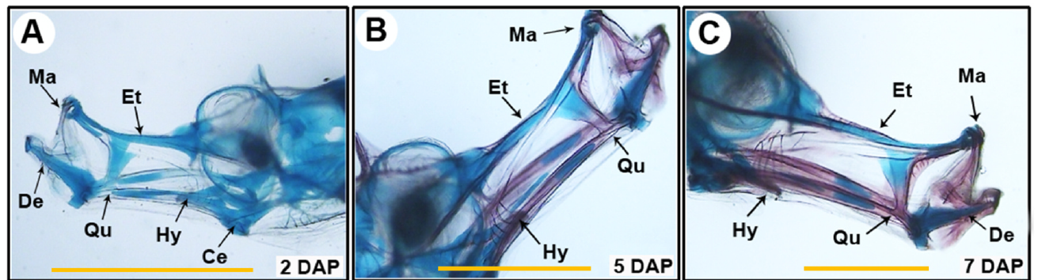
The newborn feeding skeleton is largely cartilaginous
Cartilage forms much of the early feeding skeleton in juvenile lined seahorses. Sun and colleagues stained cartilage blue and mineralized bone red, allowing the snout skeleton to be followed across postnatal ages. Jaw and associated elements were predominantly cartilaginous during the first three days.
The labeled elements include the maxilla and dentary of the jaws, and the hyoid and ceratohyal beneath them. Their coordinated movement participates in the expansion associated with suction feeding. Newborns performed successful strikes while these structures remained incompletely ossified.
By about 7 days, several snout elements displayed obvious mineralization. Feeding competence therefore preceded the later skeletal condition, while postnatal ossification changed the anatomical apparatus supporting repeated prey capture.
Sun et al. (2021), Fig. 3A–C. Snout skeleton at 2, 5, and 7 days after birth.
Sun et al. (2021)
18
Notes:
• Cartilage forms much of the early feeding skeleton in juvenile lined seahorses. Sun and colleagues stained cartilage blue and mineralized bone red, allowing the snout skeleton to be followed across postnatal ages. Jaw and associated elements were predominantly cartilaginous during the first three days.
– Ossification is the formation of bone, including mineralization of skeletal tissue; the stain distinguishes tissue condition rather than muscle activity.
• The labeled elements include the maxilla and dentary of the jaws, and the hyoid and ceratohyal beneath them. Their coordinated movement participates in the expansion associated with suction feeding. Newborns performed successful strikes while these structures remained incompletely ossified.
• By about 7 days, several snout elements displayed obvious mineralization. Feeding competence therefore preceded the later skeletal condition, while postnatal ossification changed the anatomical apparatus supporting repeated prey capture.
References:
Jinhui Sun, Bo Zhang, Shangduan Xie, Honghao Zhao, Yanjing Yang, Pei Cui, Xiaohan Yu, Sudong Xia, Qiang Lin, Geng Qin (2021). Kinematics of prey capture and histological development of related organs in juvenile seahorse. Aquaculture 541: 736732. https://doi.org/10.1016/j.aquaculture.2021.736732
Figure: Sun et al. (2021), Fig. 3A–C. Snout skeleton at 2, 5, and 7 days after birth.
Figure source: https://doi.org/10.1016/j.aquaculture.2021.736732

Slide 19
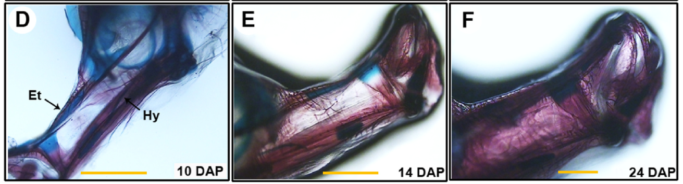
Snout ossification accompanies improved capture
Ossification progressively replaces or supplements the early cartilaginous condition with bone. In lined seahorses, jaw and associated snout elements were ossified by approximately 14 days after birth, while the later snout skeleton became fully mineralized by about 30 days.
Sun and colleagues observed a change in the developmental trajectory of feeding around 10–14 days. Capture success increased, snout expansion became less pronounced, and growth and food intake changed during the same interval. The histological and behavioral measurements therefore identify a shared developmental transition.
The mouth still captured prey through a brief coordinated strike. Maturation altered the dimensions and tissue properties of the feeding apparatus while preserving pivot feeding as the animal’s basic acquisition strategy.
Sun et al. (2021), Fig. 3D–F. Snout skeleton at 10, 14, and 24 days after birth.
Sun et al. (2021)
19
Notes:
• Ossification progressively replaces or supplements the early cartilaginous condition with bone. In lined seahorses, jaw and associated snout elements were ossified by approximately 14 days after birth, while the later snout skeleton became fully mineralized by about 30 days.
– The abstract describes an approximately 10-day transition, while the detailed results place completion of jaw-element ossification at about 14 days.
• Sun and colleagues observed a change in the developmental trajectory of feeding around 10–14 days. Capture success increased, snout expansion became less pronounced, and growth and food intake changed during the same interval. The histological and behavioral measurements therefore identify a shared developmental transition.
• The mouth still captured prey through a brief coordinated strike. Maturation altered the dimensions and tissue properties of the feeding apparatus while preserving pivot feeding as the animal’s basic acquisition strategy.
References:
Jinhui Sun, Bo Zhang, Shangduan Xie, Honghao Zhao, Yanjing Yang, Pei Cui, Xiaohan Yu, Sudong Xia, Qiang Lin, Geng Qin (2021). Kinematics of prey capture and histological development of related organs in juvenile seahorse. Aquaculture 541: 736732. https://doi.org/10.1016/j.aquaculture.2021.736732
Figure: Sun et al. (2021), Fig. 3D–F. Snout skeleton at 10, 14, and 24 days after birth.
Figure source: https://doi.org/10.1016/j.aquaculture.2021.736732

Slide 20
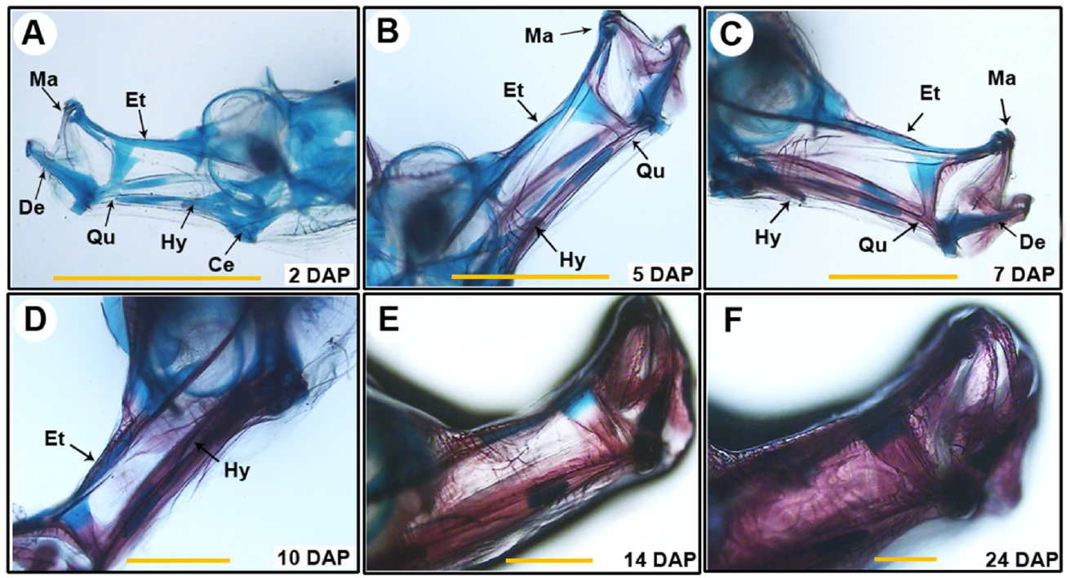
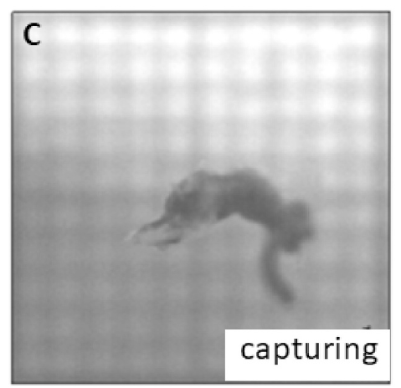
Growth extends the reach of a feeding strike
Attack distance was defined by Sun and colleagues as the maximum distance traveled by the snout tip during capture. In lined seahorses, this distance increased from about 1.14 mm on the first day after birth to 3.18 mm by day 30.
Snout length increased from approximately 0.78 mm to 3.75 mm over the same interval. A longer feeding apparatus accompanied a larger capture reach, while body height increased from about 9.2 mm to 43.2 mm. Growth therefore changed the spatial scale of prey acquisition.
Capture success rose from about 77% in newborns to about 92% at day 30 under the study conditions. Increasing reach and success developed within an already functional visually guided feeding sequence.
Sun et al. (2021), Fig. 3A–F. Cartilage and bone during snout development.
Sun et al. (2021), Fig. 1C. Rapid capture with the snout.
Sun et al. (2021)
20
Notes:
• Attack distance was defined by Sun and colleagues as the maximum distance traveled by the snout tip during capture. In lined seahorses, this distance increased from about 1.14 mm on the first day after birth to 3.18 mm by day 30.
– The reported attack distance is snout-tip displacement; it should not be confused with the initial mouth-to-prey separation measured in the dwarf-seahorse hydrodynamic study.
• Snout length increased from approximately 0.78 mm to 3.75 mm over the same interval. A longer feeding apparatus accompanied a larger capture reach, while body height increased from about 9.2 mm to 43.2 mm. Growth therefore changed the spatial scale of prey acquisition.
• Capture success rose from about 77% in newborns to about 92% at day 30 under the study conditions. Increasing reach and success developed within an already functional visually guided feeding sequence.
References:
Jinhui Sun, Bo Zhang, Shangduan Xie, Honghao Zhao, Yanjing Yang, Pei Cui, Xiaohan Yu, Sudong Xia, Qiang Lin, Geng Qin (2021). Kinematics of prey capture and histological development of related organs in juvenile seahorse. Aquaculture 541: 736732. https://doi.org/10.1016/j.aquaculture.2021.736732
Figure: Sun et al. (2021), Fig. 3A–F. Cartilage and bone during snout development.
Figure source: https://doi.org/10.1016/j.aquaculture.2021.736732
Figure: Sun et al. (2021), Fig. 1C. Rapid capture with the snout.
Figure source: https://doi.org/10.1016/j.aquaculture.2021.736732

Slide 21
Snout expansion declines as the skeleton matures
Feeding caliber is the maximum snout width reached during suction feeding. Sun and colleagues compared this width with the resting snout width to describe expansion. Newborn lined seahorses expanded to about 216% of their resting width, whereas the value was about 106% by day 14.
The increasingly mineralized skeleton accompanied a less expandable snout. At later ages, feeding caliber and resting width became similar, even though absolute snout dimensions and capture reach increased. Growth therefore changed both size and the proportional deformation during feeding.
The early flexible snout allowed newborns to take comparatively large prey. Later animals retained rapid suction feeding with a larger, more ossified apparatus and a smaller relative change in width.
Sun et al. (2021), Fig. 3A–C. Snout skeleton at 2, 5, and 7 days after birth.
Sun et al. (2021), Fig. 3D–F. Snout skeleton at 10, 14, and 24 days after birth.
Sun et al. (2021)
21
Notes:
• Feeding caliber is the maximum snout width reached during suction feeding. Sun and colleagues compared this width with the resting snout width to describe expansion. Newborn lined seahorses expanded to about 216% of their resting width, whereas the value was about 106% by day 14.
– The early flexibility is an interpretation discussed by the authors, supported by the paired kinematic and skeletal-staining observations.
• The increasingly mineralized skeleton accompanied a less expandable snout. At later ages, feeding caliber and resting width became similar, even though absolute snout dimensions and capture reach increased. Growth therefore changed both size and the proportional deformation during feeding.
• The early flexible snout allowed newborns to take comparatively large prey. Later animals retained rapid suction feeding with a larger, more ossified apparatus and a smaller relative change in width.
References:
Jinhui Sun, Bo Zhang, Shangduan Xie, Honghao Zhao, Yanjing Yang, Pei Cui, Xiaohan Yu, Sudong Xia, Qiang Lin, Geng Qin (2021). Kinematics of prey capture and histological development of related organs in juvenile seahorse. Aquaculture 541: 736732. https://doi.org/10.1016/j.aquaculture.2021.736732
Figure: Sun et al. (2021), Fig. 3A–C. Snout skeleton at 2, 5, and 7 days after birth.
Figure source: https://doi.org/10.1016/j.aquaculture.2021.736732
Figure: Sun et al. (2021), Fig. 3D–F. Snout skeleton at 10, 14, and 24 days after birth.
Figure source: https://doi.org/10.1016/j.aquaculture.2021.736732

Slide 22
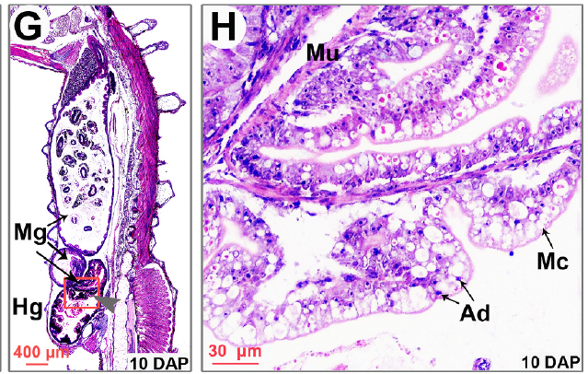
The intestine matures while daily intake rises
Newborn lined seahorses had a short, relatively straight intestine with a thin mucosal layer. Mucosa is the inner tissue lining the digestive lumen. During the first postnatal days, folds and loops developed, increasing the complexity of the organ that receives captured food.
By about 10 days after birth, three intestinal loops were visible and the muscular wall was thicker. Sun and colleagues documented these changes with stained sections, alongside the increasing food intake measured in the feeding experiment.
Daily intake rose from about 1.2 mg per seahorse at birth to 46.3 mg by day 30. Relative intake decreased from about 43% of body mass per day in newborns to approximately 17–22% in later juveniles.
Sun et al. (2021), Fig. 5G–H. Intestinal loops and wall layers at 10 days after birth.
Sun et al. (2021)
22
Notes:
• Newborn lined seahorses had a short, relatively straight intestine with a thin mucosal layer. Mucosa is the inner tissue lining the digestive lumen. During the first postnatal days, folds and loops developed, increasing the complexity of the organ that receives captured food.
– The species lacks a typical stomach in the source description, so the intestinal tract bears much of the digestive role.
• By about 10 days after birth, three intestinal loops were visible and the muscular wall was thicker. Sun and colleagues documented these changes with stained sections, alongside the increasing food intake measured in the feeding experiment.
• Daily intake rose from about 1.2 mg per seahorse at birth to 46.3 mg by day 30. Relative intake decreased from about 43% of body mass per day in newborns to approximately 17–22% in later juveniles.
References:
Jinhui Sun, Bo Zhang, Shangduan Xie, Honghao Zhao, Yanjing Yang, Pei Cui, Xiaohan Yu, Sudong Xia, Qiang Lin, Geng Qin (2021). Kinematics of prey capture and histological development of related organs in juvenile seahorse. Aquaculture 541: 736732. https://doi.org/10.1016/j.aquaculture.2021.736732
Figure: Sun et al. (2021), Fig. 5G–H. Intestinal loops and wall layers at 10 days after birth.
Figure source: https://doi.org/10.1016/j.aquaculture.2021.736732

Slide 23
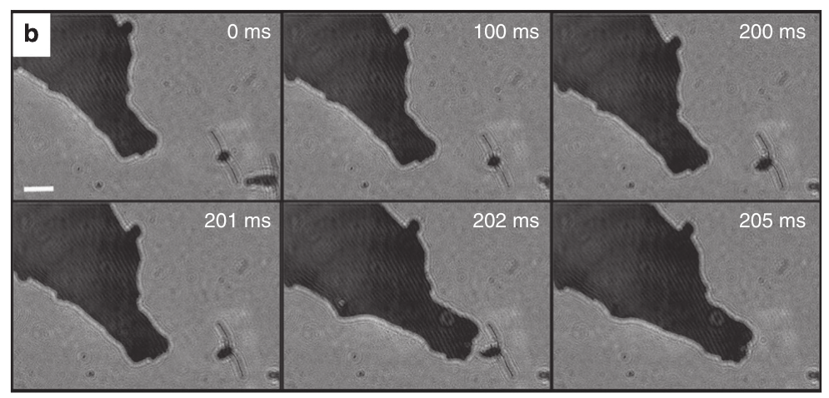
A slow predator can approach evasive copepods
Dwarf seahorses, Hippocampus zosterae, capture copepods, small swimming crustaceans that detect disturbances in the surrounding water. Gemmell and colleagues studied approaches to Acartia tonsa using high-speed holography, a method that reconstructs positions and particle movement within a three-dimensional sample volume.
About 84% of approaches brought the copepod within roughly 1 mm without triggering escape. Once prey entered capture range, capture succeeded about 94% of the time. Successful feeding therefore combined an undetected approach with an exceptionally rapid final strike.
The approach and strike solve different problems. Slow positioning limits the warning available to the prey, while head rotation rapidly closes the remaining short distance.
Gemmell et al. (2013), Fig. 2b. Successful feeding sequence recorded by holography.
Gemmell et al. (2013)
23
Notes:
• Dwarf seahorses, Hippocampus zosterae, capture copepods, small swimming crustaceans that detect disturbances in the surrounding water. Gemmell and colleagues studied approaches to Acartia tonsa using high-speed holography, a method that reconstructs positions and particle movement within a three-dimensional sample volume.
– The experiments used dwarf seahorses approximately 2.5 cm long and copepods with body lengths around 0.8–1.1 mm.
• About 84% of approaches brought the copepod within roughly 1 mm without triggering escape. Once prey entered capture range, capture succeeded about 94% of the time. Successful feeding therefore combined an undetected approach with an exceptionally rapid final strike.
• The approach and strike solve different problems. Slow positioning limits the warning available to the prey, while head rotation rapidly closes the remaining short distance.
References:
Brad J. Gemmell, Jian Sheng, Edward J. Buskey (2013). Morphology of seahorse head hydrodynamically aids in capture of evasive prey. Nature Communications 4: 2840. https://doi.org/10.1038/ncomms3840
Figure: Gemmell et al. (2013), Fig. 2b. Successful feeding sequence recorded by holography.
Figure source: https://doi.org/10.1038/ncomms3840

Slide 24
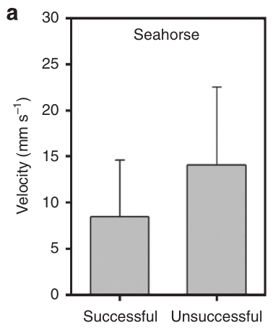
Successful approaches were slower than failed ones
Approach speed differed between successful and failed dwarf-seahorse feeding attempts. Gemmell and colleagues measured successful approaches at about 8.4 mm/s and unsuccessful approaches at about 14.1 mm/s. These values describe the movement before the final pivot-feeding strike.
A moving head deforms the surrounding water. Hydrodynamic disturbance is the resulting change in water motion that a mechanosensitive prey animal can detect. Faster approaches increased the disturbance near the region where the copepod would eventually be captured.
The seahorse’s short-range strike therefore depended on careful preceding positioning. Rapid final acquisition was compatible with a slower approach, because minimizing the prey’s warning and minimizing the final capture time require different movement patterns.
Gemmell et al. (2013), Fig. 1a. Approach speeds for successful and failed feeding attempts.
Gemmell et al. (2013)
24
Notes:
• Approach speed differed between successful and failed dwarf-seahorse feeding attempts. Gemmell and colleagues measured successful approaches at about 8.4 mm/s and unsuccessful approaches at about 14.1 mm/s. These values describe the movement before the final pivot-feeding strike.
– The speed comparison concerns observed feeding outcomes; the flume measurements separately tested how imposed flow speed changed disturbance around preserved heads.
• A moving head deforms the surrounding water. Hydrodynamic disturbance is the resulting change in water motion that a mechanosensitive prey animal can detect. Faster approaches increased the disturbance near the region where the copepod would eventually be captured.
• The seahorse’s short-range strike therefore depended on careful preceding positioning. Rapid final acquisition was compatible with a slower approach, because minimizing the prey’s warning and minimizing the final capture time require different movement patterns.
References:
Brad J. Gemmell, Jian Sheng, Edward J. Buskey (2013). Morphology of seahorse head hydrodynamically aids in capture of evasive prey. Nature Communications 4: 2840. https://doi.org/10.1038/ncomms3840
Figure: Gemmell et al. (2013), Fig. 1a. Approach speeds for successful and failed feeding attempts.
Figure source: https://doi.org/10.1038/ncomms3840

Slide 25
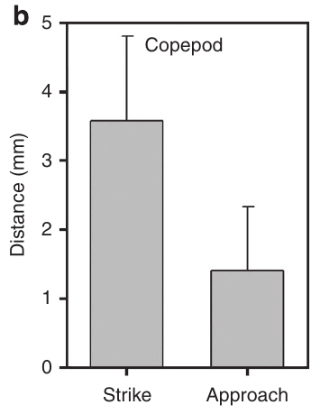
The final strike outruns a copepod response
High-speed recordings at 2,000 frames/s resolved the final dwarf-seahorse strike. The mouth covered the remaining distance to the copepod in less than 1 ms. The source contrasts this interval with copepod escape-response latencies of approximately 2–4 ms reported in earlier work.
Response latency is the time between detection of a stimulus and the beginning of a response. A strike completed before that interval expires can acquire the prey before an effective escape movement develops. The advantage depends on beginning within the very short capture range.
Nearby copepods could respond to the disturbance produced by a completed strike. The captured target and surrounding animals therefore encountered different timing relationships between detection, escape, and the rapidly moving mouth.
Gemmell et al. (2013), Fig. 2b. Successful feeding sequence recorded by holography.
Gemmell et al. (2013), Fig. 1b. Copepod response distances to approaches and strikes.
Gemmell et al. (2013)
25
Notes:
• High-speed recordings at 2,000 frames/s resolved the final dwarf-seahorse strike. The mouth covered the remaining distance to the copepod in less than 1 ms. The source contrasts this interval with copepod escape-response latencies of approximately 2–4 ms reported in earlier work.
– The paper observed no strikes at initial prey distances exceeding 1.4 mm; the exceptional speed is a close-range advantage.
• Response latency is the time between detection of a stimulus and the beginning of a response. A strike completed before that interval expires can acquire the prey before an effective escape movement develops. The advantage depends on beginning within the very short capture range.
• Nearby copepods could respond to the disturbance produced by a completed strike. The captured target and surrounding animals therefore encountered different timing relationships between detection, escape, and the rapidly moving mouth.
References:
Brad J. Gemmell, Jian Sheng, Edward J. Buskey (2013). Morphology of seahorse head hydrodynamically aids in capture of evasive prey. Nature Communications 4: 2840. https://doi.org/10.1038/ncomms3840
Figure: Gemmell et al. (2013), Fig. 2b. Successful feeding sequence recorded by holography.
Figure source: https://doi.org/10.1038/ncomms3840
Figure: Gemmell et al. (2013), Fig. 1b. Copepod response distances to approaches and strikes.
Figure source: https://doi.org/10.1038/ncomms3840

Slide 26
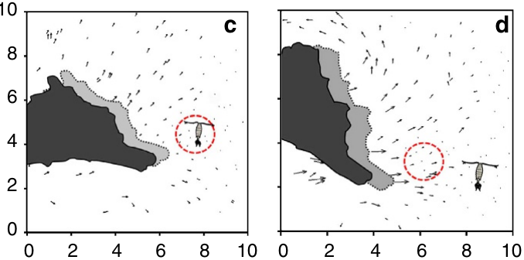
A quiet water region lies above the snout
Particle tracking follows small suspended tracers to estimate local water movement. Gemmell and colleagues used live diatoms as tracers during dwarf-seahorse approaches and reconstructed their positions holographically. Water motion above the snout was lower than in adjacent regions.
Within the measured capture region, water velocities did not exceed about 0.8 mm/s, whereas neighboring regions reached about 4.1 mm/s. The prey could occupy a comparatively quiet zone even though the moving predator disturbed water elsewhere around its head.
This spatial pattern connects head form with prey detection. The mouth rotates toward the zone during capture, so the location with reduced warning also lies within the range reached by pivot feeding.
Gemmell et al. (2013), Fig. 3c–d. Particle motions around successful and failed approaches.
Gemmell et al. (2013)
26
Notes:
• Particle tracking follows small suspended tracers to estimate local water movement. Gemmell and colleagues used live diatoms as tracers during dwarf-seahorse approaches and reconstructed their positions holographically. Water motion above the snout was lower than in adjacent regions.
– The quiet region occurred during both successful and failed approaches; disturbance magnitude and target position still affected the outcome.
• Within the measured capture region, water velocities did not exceed about 0.8 mm/s, whereas neighboring regions reached about 4.1 mm/s. The prey could occupy a comparatively quiet zone even though the moving predator disturbed water elsewhere around its head.
• This spatial pattern connects head form with prey detection. The mouth rotates toward the zone during capture, so the location with reduced warning also lies within the range reached by pivot feeding.
References:
Brad J. Gemmell, Jian Sheng, Edward J. Buskey (2013). Morphology of seahorse head hydrodynamically aids in capture of evasive prey. Nature Communications 4: 2840. https://doi.org/10.1038/ncomms3840
Figure: Gemmell et al. (2013), Fig. 3c–d. Particle motions around successful and failed approaches.
Figure source: https://doi.org/10.1038/ncomms3840

Slide 27
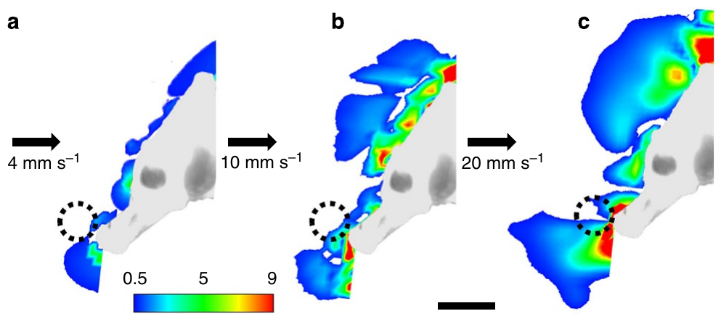
Increasing flow erodes the quiet capture zone
Gemmell and colleagues placed preserved dwarf-seahorse heads in a flow chamber and measured water movement with particle image velocimetry, which estimates velocity from displacement of illuminated particles. Imposed flow represented the relative movement occurring during an approach.
Deformation rate, measured in s⁻¹, describes how rapidly nearby water is strained. At 4 mm/s, almost none of the capture zone exceeded the approximately 0.5 s⁻¹ detection threshold discussed for Acartia tonsa. At 10 mm/s part of the zone exceeded it, and at 20 mm/s much more did.
The head’s geometry preserved a relatively quiet region, but the absolute disturbance increased with approach speed. The flow experiment therefore explains why a favorable head shape still benefits from a slow approach.
Gemmell et al. (2013), Fig. 4a–c. Flow deformation at different approach speeds.
Gemmell et al. (2013)
27
Notes:
• Gemmell and colleagues placed preserved dwarf-seahorse heads in a flow chamber and measured water movement with particle image velocimetry, which estimates velocity from displacement of illuminated particles. Imposed flow represented the relative movement occurring during an approach.
– The preserved-head preparation isolates effects of geometry and posture without active swimming or a live prey animal changing position.
• Deformation rate, measured in s⁻¹, describes how rapidly nearby water is strained. At 4 mm/s, almost none of the capture zone exceeded the approximately 0.5 s⁻¹ detection threshold discussed for Acartia tonsa. At 10 mm/s part of the zone exceeded it, and at 20 mm/s much more did.
• The head’s geometry preserved a relatively quiet region, but the absolute disturbance increased with approach speed. The flow experiment therefore explains why a favorable head shape still benefits from a slow approach.
References:
Brad J. Gemmell, Jian Sheng, Edward J. Buskey (2013). Morphology of seahorse head hydrodynamically aids in capture of evasive prey. Nature Communications 4: 2840. https://doi.org/10.1038/ncomms3840
Figure: Gemmell et al. (2013), Fig. 4a–c. Flow deformation at different approach speeds.
Figure source: https://doi.org/10.1038/ncomms3840

Slide 28
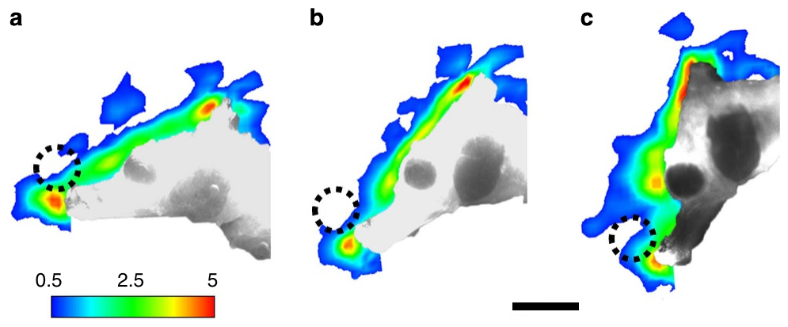
Head posture changes the disturbance reaching prey
Posture determines which surfaces of the seahorse head meet the incoming water. Gemmell and colleagues varied head angle in a flow chamber while measuring deformation around preserved dwarf seahorses. The naturally observed posture produced the lowest disturbance within the capture region.
Live approaches also maintained a consistent relationship between head and target. The angle from the top of the head through the snout tip toward the copepod averaged about 124°, and head rotation during the approach remained small.
Geometry and behavior therefore work together before the strike. The narrow snout creates a favorable flow distribution, and the animal maintains an orientation that places its target within the quiet portion of that distribution.
Gemmell et al. (2013), Fig. 5a–c. Flow deformation around different seahorse head postures.
Gemmell et al. (2013)
28
Notes:
• Posture determines which surfaces of the seahorse head meet the incoming water. Gemmell and colleagues varied head angle in a flow chamber while measuring deformation around preserved dwarf seahorses. The naturally observed posture produced the lowest disturbance within the capture region.
– The source separates approach posture from the large, rapid head rotation used during the capture phase.
• Live approaches also maintained a consistent relationship between head and target. The angle from the top of the head through the snout tip toward the copepod averaged about 124°, and head rotation during the approach remained small.
• Geometry and behavior therefore work together before the strike. The narrow snout creates a favorable flow distribution, and the animal maintains an orientation that places its target within the quiet portion of that distribution.
References:
Brad J. Gemmell, Jian Sheng, Edward J. Buskey (2013). Morphology of seahorse head hydrodynamically aids in capture of evasive prey. Nature Communications 4: 2840. https://doi.org/10.1038/ncomms3840
Figure: Gemmell et al. (2013), Fig. 5a–c. Flow deformation around different seahorse head postures.
Figure source: https://doi.org/10.1038/ncomms3840

Slide 29
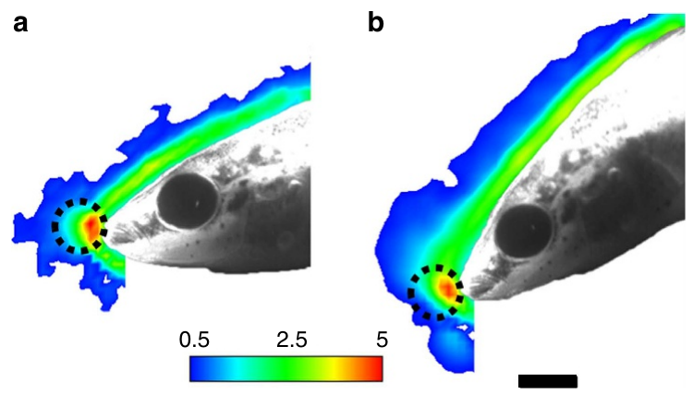
A stickleback head produces a different flow field
The three-spined stickleback, Gasterosteus aculeatus, lacks the seahorse’s elongated tubular snout. Gemmell and colleagues used preserved sticklebacks as a morphological comparison in the same flow measurements. Their heads produced a relatively uniform bow wave with strong deformation directly ahead of the mouth.
A bow wave is the water disturbance generated in front of an advancing object. Changing stickleback head posture did little to reduce deformation at the short distances used for seahorse strikes. The comparison separates a general consequence of moving through water from the distinctive seahorse geometry.
Different feeding anatomies therefore create different sensory conditions for prey. The seahorse places its capture region within a low-disturbance zone, whereas the stickleback’s frontal region remains comparatively exposed to deformation.
Gemmell et al. (2013), Fig. 6a–b. Flow deformation around a stickleback head.
Gemmell et al. (2013), Fig. 5a–c. Flow deformation around different seahorse head postures.
Gemmell et al. (2013)
29
Notes:
• The three-spined stickleback, Gasterosteus aculeatus, lacks the seahorse’s elongated tubular snout. Gemmell and colleagues used preserved sticklebacks as a morphological comparison in the same flow measurements. Their heads produced a relatively uniform bow wave with strong deformation directly ahead of the mouth.
– The comparison concerns hydrodynamic geometry, not a direct comparison of live stickleback and seahorse capture success.
• A bow wave is the water disturbance generated in front of an advancing object. Changing stickleback head posture did little to reduce deformation at the short distances used for seahorse strikes. The comparison separates a general consequence of moving through water from the distinctive seahorse geometry.
• Different feeding anatomies therefore create different sensory conditions for prey. The seahorse places its capture region within a low-disturbance zone, whereas the stickleback’s frontal region remains comparatively exposed to deformation.
References:
Brad J. Gemmell, Jian Sheng, Edward J. Buskey (2013). Morphology of seahorse head hydrodynamically aids in capture of evasive prey. Nature Communications 4: 2840. https://doi.org/10.1038/ncomms3840
Figure: Gemmell et al. (2013), Fig. 6a–b. Flow deformation around a stickleback head.
Figure source: https://doi.org/10.1038/ncomms3840
Figure: Gemmell et al. (2013), Fig. 5a–c. Flow deformation around different seahorse head postures.
Figure source: https://doi.org/10.1038/ncomms3840

Slide 30
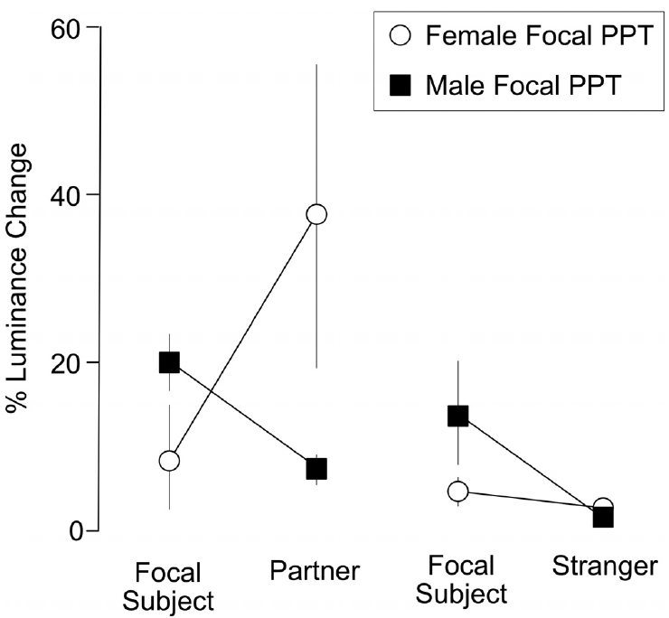
Pairing changes the context of visual interaction
Mederos and colleagues paired male and female lined seahorses for 5 days, then tested interactions with the familiar partner and an opposite-sex stranger. The animals occupied separate sections of a test tank, allowing their brightness changes to be analyzed during proximity to either individual.
Luminance describes brightness in a visual channel rather than hue, the kind of color perceived. The researchers calibrated video images and evaluated changes in abdominal luminance using a seahorse visual model. Partner interactions produced larger and more correlated changes than stranger interactions.
The measured social response was context-dependent brightening. Familiarity with a specific individual altered visual interaction even when both available animals were potential opposite-sex social partners.
Mederos et al. (2022), Fig. 2. Partner and stranger interactions differ in luminance change.
Mederos et al. (2022)
30
Notes:
• Mederos and colleagues paired male and female lined seahorses for 5 days, then tested interactions with the familiar partner and an opposite-sex stranger. The animals occupied separate sections of a test tank, allowing their brightness changes to be analyzed during proximity to either individual.
– The article distinguishes social monogamy, meaning pair living, from an affective pair bond assessed through partner preference, separation distress, and social buffering.
• Luminance describes brightness in a visual channel rather than hue, the kind of color perceived. The researchers calibrated video images and evaluated changes in abdominal luminance using a seahorse visual model. Partner interactions produced larger and more correlated changes than stranger interactions.
• The measured social response was context-dependent brightening. Familiarity with a specific individual altered visual interaction even when both available animals were potential opposite-sex social partners.
References:
Sabrina L. Mederos, Rafael C. Duarte, Mira Mastoras, Megan Y. Dennis, Matthew L. Settles, Allison R. Lau, Alexandria Scott, Kacie Woodward, Colby Johnson, Adele M. H. Seelke, Karen L. Bales (2022). Effects of pairing on color change and central gene expression in lined seahorses. Genes, Brain and Behavior 21: e12812. https://doi.org/10.1111/gbb.12812
Figure: Mederos et al. (2022), Fig. 2. Partner and stranger interactions differ in luminance change.
Figure source: https://doi.org/10.1111/gbb.12812

Slide 31
Male brightening exceeds the female response
Males produced most of the luminance-change events observed during mutual partner proximity. In tests with a male as the focal animal, his abdominal luminance increased by about 20% during partner interactions, while his female partner increased by about 7%.
The same focal males brightened by about 14% during interactions with stranger females. Females used as stranger stimulus animals changed far less. Sex-dependent signaling therefore involved both the identity of the receiver and differences between male and female responses.
When the female was focal, her familiar male partner showed a particularly large brightness response, averaging about 38%. The interaction is asymmetric: both animals can change luminance, but the male carries much of the observed visual display.
Mederos et al. (2022), Fig. 2. Partner and stranger interactions differ in luminance change.
Mederos et al. (2022)
31
Notes:
• Males produced most of the luminance-change events observed during mutual partner proximity. In tests with a male as the focal animal, his abdominal luminance increased by about 20% during partner interactions, while his female partner increased by about 7%.
– The numerical values are percent changes from each animal’s baseline luminance, not the fraction of the body surface changing color.
• The same focal males brightened by about 14% during interactions with stranger females. Females used as stranger stimulus animals changed far less. Sex-dependent signaling therefore involved both the identity of the receiver and differences between male and female responses.
• When the female was focal, her familiar male partner showed a particularly large brightness response, averaging about 38%. The interaction is asymmetric: both animals can change luminance, but the male carries much of the observed visual display.
References:
Sabrina L. Mederos, Rafael C. Duarte, Mira Mastoras, Megan Y. Dennis, Matthew L. Settles, Allison R. Lau, Alexandria Scott, Kacie Woodward, Colby Johnson, Adele M. H. Seelke, Karen L. Bales (2022). Effects of pairing on color change and central gene expression in lined seahorses. Genes, Brain and Behavior 21: e12812. https://doi.org/10.1111/gbb.12812
Figure: Mederos et al. (2022), Fig. 2. Partner and stranger interactions differ in luminance change.
Figure source: https://doi.org/10.1111/gbb.12812

Slide 32
Partner luminance changes can be coordinated
Behavioral synchrony occurs when interacting animals coordinate their actions in time. Mederos and colleagues recorded partner-associated luminance changes in lined seahorses, including occasions when a male’s brightening was followed by a female response after a short delay.
The mean delay in those coordinated events was approximately 13 s. Most luminance changes were performed by the male alone, so coordinated brightening was one component of the interaction rather than the only display pattern. Partner identity also altered the magnitude of the response.
The authors hypothesized that abdominal brightening may contribute to communication between pair mates. The measured phenomenon combines temporal coordination with partner-associated brightness changes, linking a visible body response to the social context.
Mederos et al. (2022), Fig. 2. Partner and stranger interactions differ in luminance change.
Mederos et al. (2022)
32
Notes:
• Behavioral synchrony occurs when interacting animals coordinate their actions in time. Mederos and colleagues recorded partner-associated luminance changes in lined seahorses, including occasions when a male’s brightening was followed by a female response after a short delay.
– The article treats color change as a candidate communication mechanism; it did not experimentally prevent a display to test its necessity for maintaining a pair.
• The mean delay in those coordinated events was approximately 13 s. Most luminance changes were performed by the male alone, so coordinated brightening was one component of the interaction rather than the only display pattern. Partner identity also altered the magnitude of the response.
• The authors hypothesized that abdominal brightening may contribute to communication between pair mates. The measured phenomenon combines temporal coordination with partner-associated brightness changes, linking a visible body response to the social context.
References:
Sabrina L. Mederos, Rafael C. Duarte, Mira Mastoras, Megan Y. Dennis, Matthew L. Settles, Allison R. Lau, Alexandria Scott, Kacie Woodward, Colby Johnson, Adele M. H. Seelke, Karen L. Bales (2022). Effects of pairing on color change and central gene expression in lined seahorses. Genes, Brain and Behavior 21: e12812. https://doi.org/10.1111/gbb.12812
Figure: Mederos et al. (2022), Fig. 2. Partner and stranger interactions differ in luminance change.
Figure source: https://doi.org/10.1111/gbb.12812

Slide 33
Visual modeling uses the receiver’s cone sensitivities
A visual model estimates how an animal’s photoreceptors respond to reflected light. Mederos and colleagues used published sensitivities from Hippocampus subelongatus to analyze lined-seahorse displays. The source values included cone sensitivity peaks at 467, 522, 537, and 560 nm.
Spectral sensitivity describes response across light wavelengths. The model assigned the 537 nm channel to brightness and used calibrated images to estimate light captured by the different cone classes. This separates the receiver’s modeled luminance from a human judgment that a seahorse looks brighter.
Using sensitivities from another species is a model assumption, because equivalent measurements were unavailable for the lined seahorse. The resulting analysis specifically concerns brightness changes estimated under that assumption.
Sun et al. (2021), Fig. 4A–B. Newborn eye and labeled retinal layers.
Mederos et al. (2022), Fig. 2. Partner and stranger interactions differ in luminance change.
Mederos et al. (2022); Sun et al. (2021)
33
Notes:
• A visual model estimates how an animal’s photoreceptors respond to reflected light. Mederos and colleagues used published sensitivities from Hippocampus subelongatus to analyze lined-seahorse displays. The source values included cone sensitivity peaks at 467, 522, 537, and 560 nm.
– The model assumes that lined-seahorse photoreceptor sensitivities resemble those of a related species from a similar shallow, vegetated habitat; this assumption governs the brightness estimate.
• Spectral sensitivity describes response across light wavelengths. The model assigned the 537 nm channel to brightness and used calibrated images to estimate light captured by the different cone classes. This separates the receiver’s modeled luminance from a human judgment that a seahorse looks brighter.
• Using sensitivities from another species is a model assumption, because equivalent measurements were unavailable for the lined seahorse. The resulting analysis specifically concerns brightness changes estimated under that assumption.
References:
Sabrina L. Mederos, Rafael C. Duarte, Mira Mastoras, Megan Y. Dennis, Matthew L. Settles, Allison R. Lau, Alexandria Scott, Kacie Woodward, Colby Johnson, Adele M. H. Seelke, Karen L. Bales (2022). Effects of pairing on color change and central gene expression in lined seahorses. Genes, Brain and Behavior 21: e12812. https://doi.org/10.1111/gbb.12812
Jinhui Sun, Bo Zhang, Shangduan Xie, Honghao Zhao, Yanjing Yang, Pei Cui, Xiaohan Yu, Sudong Xia, Qiang Lin, Geng Qin (2021). Kinematics of prey capture and histological development of related organs in juvenile seahorse. Aquaculture 541: 736732. https://doi.org/10.1016/j.aquaculture.2021.736732
Figure: Sun et al. (2021), Fig. 4A–B. Newborn eye and labeled retinal layers.
Figure source: https://doi.org/10.1016/j.aquaculture.2021.736732
Figure: Mederos et al. (2022), Fig. 2. Partner and stranger interactions differ in luminance change.
Figure source: https://doi.org/10.1111/gbb.12812

Slide 34
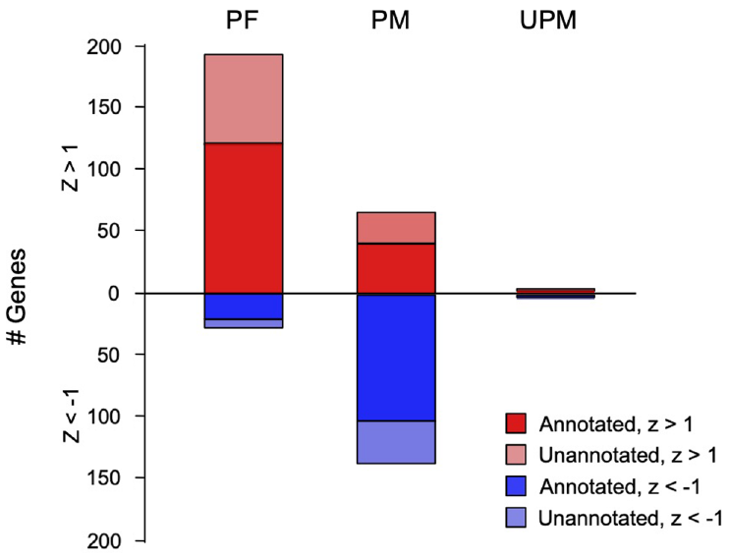
Pairing studies sampled whole-brain gene expression
After behavioral testing, Mederos and colleagues extracted RNA, the molecules carrying gene transcripts, from individual whole brains. RNA sequencing estimated the abundance of thousands of transcripts in paired males, paired females, and unpaired males. Whole-brain sampling combines contributions from multiple regions and cell types.
The exploratory profiles included metabolic, hormonal, and cilia-associated processes. Cilia are small cellular projections implicated in sensing and signaling. The authors proposed that pairing-related metabolic differences might accompany social activity, neural activity, preparation for pregnancy, or several of these processes.
Individual gene differences did not survive the study’s correction for testing many genes. These expression patterns are therefore exploratory candidates, while the behavioral observations directly describe the partner-associated luminance response.
Mederos et al. (2022), Fig. 3. Exploratory expression profiles of paired and unpaired groups.
Senarat et al. (2020), Fig. 13. Sagittal brain histology with the five major divisions.
Mederos et al. (2022); Senarat et al. (2020)
34
Notes:
• After behavioral testing, Mederos and colleagues extracted RNA, the molecules carrying gene transcripts, from individual whole brains. RNA sequencing estimated the abundance of thousands of transcripts in paired males, paired females, and unpaired males. Whole-brain sampling combines contributions from multiple regions and cell types.
– The study used each brain separately rather than pooling brains, preserving individual expression profiles while sacrificing regional localization.
• The exploratory profiles included metabolic, hormonal, and cilia-associated processes. Cilia are small cellular projections implicated in sensing and signaling. The authors proposed that pairing-related metabolic differences might accompany social activity, neural activity, preparation for pregnancy, or several of these processes.
• Individual gene differences did not survive the study’s correction for testing many genes. These expression patterns are therefore exploratory candidates, while the behavioral observations directly describe the partner-associated luminance response.
References:
Sabrina L. Mederos, Rafael C. Duarte, Mira Mastoras, Megan Y. Dennis, Matthew L. Settles, Allison R. Lau, Alexandria Scott, Kacie Woodward, Colby Johnson, Adele M. H. Seelke, Karen L. Bales (2022). Effects of pairing on color change and central gene expression in lined seahorses. Genes, Brain and Behavior 21: e12812. https://doi.org/10.1111/gbb.12812
Sinlapachai Senarat, Jes Kettratad, Gen Kaneko, Thatpon Kamnurdnin, Chanyut Sudtongkong (2020). The microanatomy of the central nervous system and brain of the Indo-Pacific seahorse, Hippocampus barbouri, during development. Zoologia 37: e53734, 1–11. https://doi.org/10.3897/zoologia.37.e53734
Figure: Mederos et al. (2022), Fig. 3. Exploratory expression profiles of paired and unpaired groups.
Figure source: https://doi.org/10.1111/gbb.12812
Figure: Senarat et al. (2020), Fig. 13. Sagittal brain histology with the five major divisions.
Figure source: https://doi.org/10.3897/zoologia.37.e53734

Slide 35
Receptor transcripts suggest candidate social pathways
A receptor is a protein that receives a signal and changes cellular activity. Mederos and colleagues examined transcripts for nonapeptide, dopamine, serotonin, and opioid receptor systems previously associated with social behavior in vertebrates. Their data describe RNA abundance rather than receptor activation.
Exploratory normalized profiles placed oxytocin-receptor transcripts relatively higher in paired females and serotonin-receptor Htr4 transcripts relatively higher in paired males. Nonapeptides are peptides of nine amino acids; fish isotocin is related to mammalian oxytocin. These comparisons identify candidate signaling systems for future seahorse experiments.
The social role of those receptors remains a hypothesis because the study did not manipulate them. The experimentally measured phenotype was partner-related brightening, which provides a behavior to test against specific receptor interventions.
Mederos et al. (2022), Fig. 3. Exploratory expression profiles of paired and unpaired groups.
Senarat et al. (2020), Fig. 13. Sagittal brain histology with the five major divisions.
Mederos et al. (2022); Senarat et al. (2020)
35
Notes:
• A receptor is a protein that receives a signal and changes cellular activity. Mederos and colleagues examined transcripts for nonapeptide, dopamine, serotonin, and opioid receptor systems previously associated with social behavior in vertebrates. Their data describe RNA abundance rather than receptor activation.
– No ligand binding, receptor blockade, or neuronal firing experiment was included, so transcript associations should not be taught as demonstrated receptor control of seahorse pair formation.
• Exploratory normalized profiles placed oxytocin-receptor transcripts relatively higher in paired females and serotonin-receptor Htr4 transcripts relatively higher in paired males. Nonapeptides are peptides of nine amino acids; fish isotocin is related to mammalian oxytocin. These comparisons identify candidate signaling systems for future seahorse experiments.
• The social role of those receptors remains a hypothesis because the study did not manipulate them. The experimentally measured phenotype was partner-related brightening, which provides a behavior to test against specific receptor interventions.
References:
Sabrina L. Mederos, Rafael C. Duarte, Mira Mastoras, Megan Y. Dennis, Matthew L. Settles, Allison R. Lau, Alexandria Scott, Kacie Woodward, Colby Johnson, Adele M. H. Seelke, Karen L. Bales (2022). Effects of pairing on color change and central gene expression in lined seahorses. Genes, Brain and Behavior 21: e12812. https://doi.org/10.1111/gbb.12812
Sinlapachai Senarat, Jes Kettratad, Gen Kaneko, Thatpon Kamnurdnin, Chanyut Sudtongkong (2020). The microanatomy of the central nervous system and brain of the Indo-Pacific seahorse, Hippocampus barbouri, during development. Zoologia 37: e53734, 1–11. https://doi.org/10.3897/zoologia.37.e53734
Figure: Mederos et al. (2022), Fig. 3. Exploratory expression profiles of paired and unpaired groups.
Figure source: https://doi.org/10.1111/gbb.12812
Figure: Senarat et al. (2020), Fig. 13. Sagittal brain histology with the five major divisions.
Figure source: https://doi.org/10.3897/zoologia.37.e53734

Slide 36
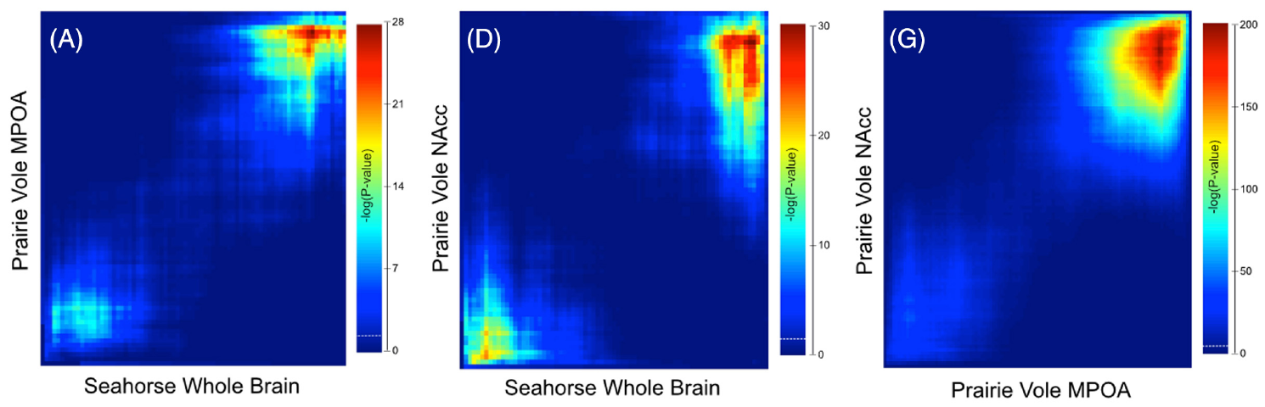
Cross-species gene rankings share endocrine themes
Orthologous genes are corresponding genes inherited from a shared ancestor. Mederos and colleagues compared ranked expression changes in seahorse whole brains with published prairie-vole brain datasets. The comparison searched for coordinated overlap rather than requiring identical changes in every individual gene.
Shared expression themes included metabolic processes and reproductive hormone-associated genes. The authors found overlap between paired male seahorses and paired male voles, even though the sampled neural tissue differed between species. These similarities connect reproduction and social state at the level of gene-expression patterns.
The overlap supports a hypothesis of shared molecular components across distinct reproductive systems. Seahorse male pregnancy and mammalian pair-associated physiology remain different biological contexts in which related endocrine genes can participate.
Mederos et al. (2022), Fig. 4A,D,G. Overlap between seahorse and prairie-vole expression rankings.
Senarat et al. (2020), Fig. 13. Sagittal brain histology with the five major divisions.
Mederos et al. (2022); Senarat et al. (2020)
36
Notes:
• Orthologous genes are corresponding genes inherited from a shared ancestor. Mederos and colleagues compared ranked expression changes in seahorse whole brains with published prairie-vole brain datasets. The comparison searched for coordinated overlap rather than requiring identical changes in every individual gene.
– The vole datasets sampled medial preoptic and nucleus accumbens tissue, whereas the seahorse samples were whole brains; matching rankings therefore do not identify homologous seahorse neural circuits.
• Shared expression themes included metabolic processes and reproductive hormone-associated genes. The authors found overlap between paired male seahorses and paired male voles, even though the sampled neural tissue differed between species. These similarities connect reproduction and social state at the level of gene-expression patterns.
• The overlap supports a hypothesis of shared molecular components across distinct reproductive systems. Seahorse male pregnancy and mammalian pair-associated physiology remain different biological contexts in which related endocrine genes can participate.
References:
Sabrina L. Mederos, Rafael C. Duarte, Mira Mastoras, Megan Y. Dennis, Matthew L. Settles, Allison R. Lau, Alexandria Scott, Kacie Woodward, Colby Johnson, Adele M. H. Seelke, Karen L. Bales (2022). Effects of pairing on color change and central gene expression in lined seahorses. Genes, Brain and Behavior 21: e12812. https://doi.org/10.1111/gbb.12812
Sinlapachai Senarat, Jes Kettratad, Gen Kaneko, Thatpon Kamnurdnin, Chanyut Sudtongkong (2020). The microanatomy of the central nervous system and brain of the Indo-Pacific seahorse, Hippocampus barbouri, during development. Zoologia 37: e53734, 1–11. https://doi.org/10.3897/zoologia.37.e53734
Figure: Mederos et al. (2022), Fig. 4A,D,G. Overlap between seahorse and prairie-vole expression rankings.
Figure source: https://doi.org/10.1111/gbb.12812
Figure: Senarat et al. (2020), Fig. 13. Sagittal brain histology with the five major divisions.
Figure source: https://doi.org/10.3897/zoologia.37.e53734

Slide 37
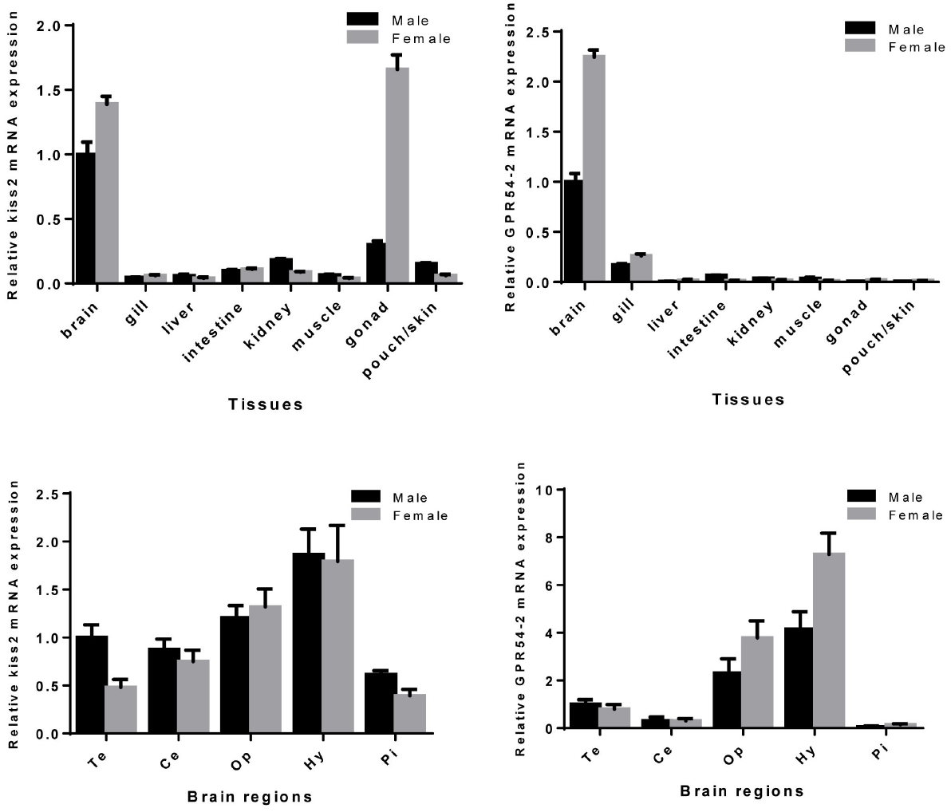
Kisspeptin signaling is concentrated in the brain
Kisspeptin is a peptide signal associated with reproductive regulation. Zhang and colleagues identified a kiss2 gene and its receptor gene, GPR54-2, in lined seahorses. Their tissue measurements found kiss2 transcripts in several locations, including brain and gonadal tissue.
GPR54-2 transcripts were concentrated in the brain and close to the detection limit in peripheral tissues. Within the brain, both ligand and receptor transcripts were especially abundant in the hypothalamic region. The complementary distribution places a peptide-producing system and a potential responding system in reproductive neural tissue.
Female brains contained higher transcript levels than male brains in the reported comparison. Sex and reproductive state therefore influence the molecular organization of the same named kisspeptin signaling system.
Zhang et al. (2018), Fig. 5. Kiss2 and GPR54-2 transcript distribution.
Senarat et al. (2020), Fig. 25. Periventricular hypothalamic cell population.
Zhang et al. (2018); Senarat et al. (2020)
37
Notes:
• Kisspeptin is a peptide signal associated with reproductive regulation. Zhang and colleagues identified a kiss2 gene and its receptor gene, GPR54-2, in lined seahorses. Their tissue measurements found kiss2 transcripts in several locations, including brain and gonadal tissue.
– A ligand is a signaling molecule that binds a receptor; tissue transcript abundance identifies candidate sites of synthesis and response rather than directly measuring peptide release.
• GPR54-2 transcripts were concentrated in the brain and close to the detection limit in peripheral tissues. Within the brain, both ligand and receptor transcripts were especially abundant in the hypothalamic region. The complementary distribution places a peptide-producing system and a potential responding system in reproductive neural tissue.
• Female brains contained higher transcript levels than male brains in the reported comparison. Sex and reproductive state therefore influence the molecular organization of the same named kisspeptin signaling system.
References:
Huixian Zhang, Bo Zhang, Geng Qin, Shuisheng Li, Qiang Lin (2018). The Roles of the Kisspeptin System in the Reproductive Physiology of the Lined Seahorse (Hippocampus erectus), an Ovoviviparous Fish With Male Pregnancy. Frontiers in Neuroscience 12: 940. https://doi.org/10.3389/fnins.2018.00940
Sinlapachai Senarat, Jes Kettratad, Gen Kaneko, Thatpon Kamnurdnin, Chanyut Sudtongkong (2020). The microanatomy of the central nervous system and brain of the Indo-Pacific seahorse, Hippocampus barbouri, during development. Zoologia 37: e53734, 1–11. https://doi.org/10.3897/zoologia.37.e53734
Figure: Zhang et al. (2018), Fig. 5. Kiss2 and GPR54-2 transcript distribution.
Figure source: https://doi.org/10.3389/fnins.2018.00940
Figure: Senarat et al. (2020), Fig. 25. Periventricular hypothalamic cell population.
Figure source: https://doi.org/10.3897/zoologia.37.e53734

Slide 38
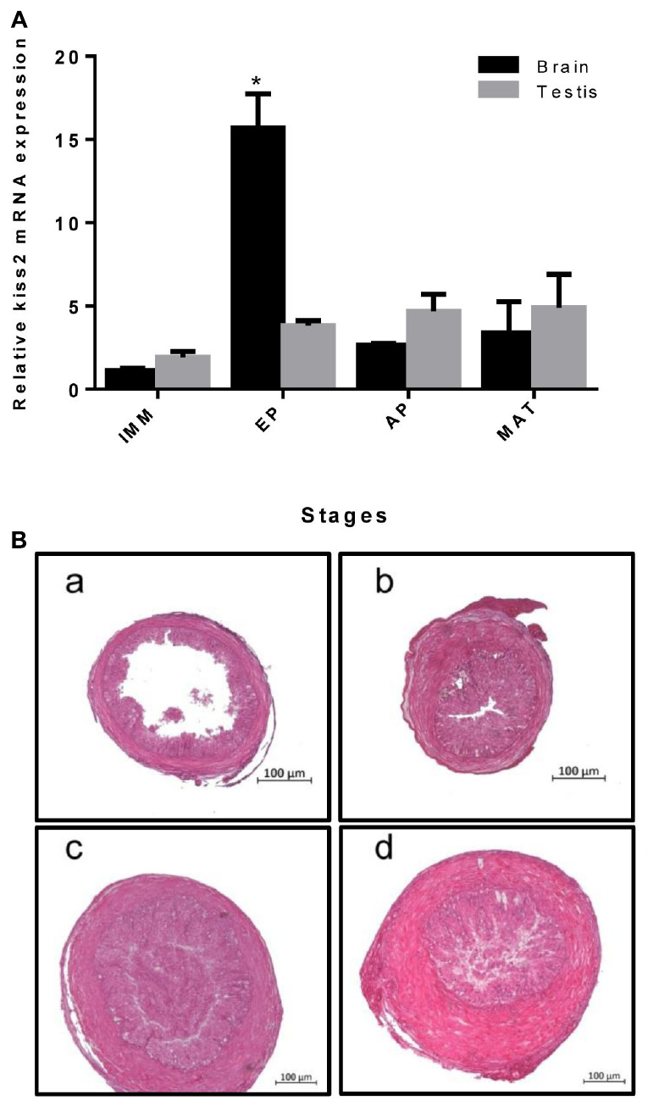
Brain Kiss2 rises near the onset of puberty
Puberty is the developmental transition toward reproductive competence. Zhang and colleagues followed male lined seahorses from immature animals at 3 months through early puberty at 4 months, advanced puberty at 5 months, and maturity at 6 months. Testis histology distinguished these developmental stages.
Brain kiss2 transcript abundance was highest around early puberty, while testis kiss2 showed no comparable developmental change. The difference places the stage-associated molecular signal primarily in the brain within the tissues examined.
The gonads continued maturing as the animals aged. Brain transcript change and testicular differentiation therefore describe complementary parts of reproductive development, with the kisspeptin system positioned as a candidate regulator of the transition rather than merely a marker of adult body size.
Zhang et al. (2018), Fig. 6A–B. Kiss2 expression and testis histology during sexual development.
Zhang et al. (2018)
38
Notes:
• Puberty is the developmental transition toward reproductive competence. Zhang and colleagues followed male lined seahorses from immature animals at 3 months through early puberty at 4 months, advanced puberty at 5 months, and maturity at 6 months. Testis histology distinguished these developmental stages.
– The study aligned endocrine transcript measurements with gonadal histology rather than assigning developmental stage from chronological age alone.
• Brain kiss2 transcript abundance was highest around early puberty, while testis kiss2 showed no comparable developmental change. The difference places the stage-associated molecular signal primarily in the brain within the tissues examined.
• The gonads continued maturing as the animals aged. Brain transcript change and testicular differentiation therefore describe complementary parts of reproductive development, with the kisspeptin system positioned as a candidate regulator of the transition rather than merely a marker of adult body size.
References:
Huixian Zhang, Bo Zhang, Geng Qin, Shuisheng Li, Qiang Lin (2018). The Roles of the Kisspeptin System in the Reproductive Physiology of the Lined Seahorse (Hippocampus erectus), an Ovoviviparous Fish With Male Pregnancy. Frontiers in Neuroscience 12: 940. https://doi.org/10.3389/fnins.2018.00940
Figure: Zhang et al. (2018), Fig. 6A–B. Kiss2 expression and testis histology during sexual development.
Figure source: https://doi.org/10.3389/fnins.2018.00940

Slide 39
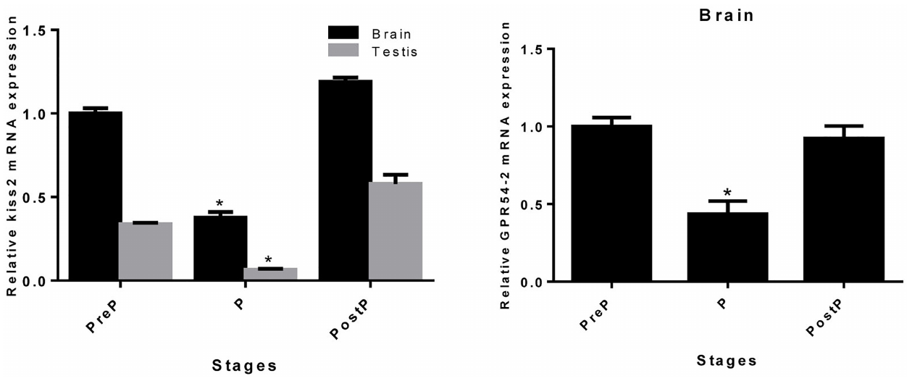
Pregnancy reduces Kiss2-associated transcripts
Zhang and colleagues compared male lined seahorses before pregnancy, during pregnancy, and after birth. Pregnancy in seahorses is the period of paternal incubation following egg transfer and fertilization. Brain and testis kiss2 transcripts decreased during that stage and returned toward preceding levels after birth.
Brain GPR54-2 transcripts also decreased during pregnancy. Ligand and receptor expression therefore changed together across the reproductive cycle in the sampled tissues. The same peptide system associated with puberty was reorganized during an adult reproductive state.
The authors hypothesized that reduced reproductive signaling during pregnancy relates to the temporary reproductive cycle. The observed return after birth identifies molecular reversibility rather than a permanent loss of the kisspeptin system.
Zhang et al. (2018), Fig. 7. Kiss2 and receptor expression across pregnancy stages.
Senarat et al. (2020), Fig. 25. Periventricular hypothalamic cell population.
Zhang et al. (2018); Senarat et al. (2020)
39
Notes:
• Zhang and colleagues compared male lined seahorses before pregnancy, during pregnancy, and after birth. Pregnancy in seahorses is the period of paternal incubation following egg transfer and fertilization. Brain and testis kiss2 transcripts decreased during that stage and returned toward preceding levels after birth.
– The measured stages were designated pre-pregnant, pregnant, and post-parturition; transcript changes should not be equated with measured peptide concentrations.
• Brain GPR54-2 transcripts also decreased during pregnancy. Ligand and receptor expression therefore changed together across the reproductive cycle in the sampled tissues. The same peptide system associated with puberty was reorganized during an adult reproductive state.
• The authors hypothesized that reduced reproductive signaling during pregnancy relates to the temporary reproductive cycle. The observed return after birth identifies molecular reversibility rather than a permanent loss of the kisspeptin system.
References:
Huixian Zhang, Bo Zhang, Geng Qin, Shuisheng Li, Qiang Lin (2018). The Roles of the Kisspeptin System in the Reproductive Physiology of the Lined Seahorse (Hippocampus erectus), an Ovoviviparous Fish With Male Pregnancy. Frontiers in Neuroscience 12: 940. https://doi.org/10.3389/fnins.2018.00940
Sinlapachai Senarat, Jes Kettratad, Gen Kaneko, Thatpon Kamnurdnin, Chanyut Sudtongkong (2020). The microanatomy of the central nervous system and brain of the Indo-Pacific seahorse, Hippocampus barbouri, during development. Zoologia 37: e53734, 1–11. https://doi.org/10.3897/zoologia.37.e53734
Figure: Zhang et al. (2018), Fig. 7. Kiss2 and receptor expression across pregnancy stages.
Figure source: https://doi.org/10.3389/fnins.2018.00940
Figure: Senarat et al. (2020), Fig. 25. Periventricular hypothalamic cell population.
Figure source: https://doi.org/10.3897/zoologia.37.e53734

Slide 40
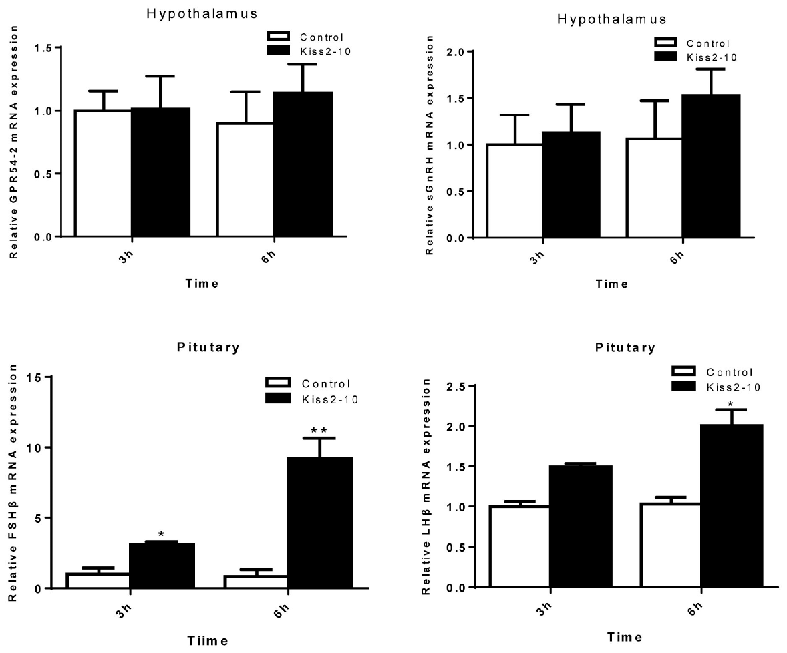
Kiss2 administration changes pituitary gene expression
Zhang and colleagues administered Kiss2-10, the mature ten-amino-acid peptide, to sexually mature male lined seahorses. They then measured brain and pituitary transcripts at 3 and 6 hours, comparing peptide-treated animals with saline-treated controls. This intervention tested physiological responsiveness to the identified signal.
Pituitary FSHβ transcripts increased at 3 hours, and both FSHβ and LHβ increased at 6 hours. Gonadotropins are pituitary hormones regulating the gonads; FSH and LH are follicle-stimulating and luteinizing hormone. Their beta-subunit transcripts identify components of those hormones.
The measured salmon-type gonadotropin-releasing hormone, sGnRH, and GPR54-2 transcripts did not increase. Pituitary gene responses can therefore occur without a parallel increase in these particular upstream transcripts over the sampled interval.
Zhang et al. (2018), Fig. 8. Endocrine transcript responses at 3 and 6 hours after Kiss2-10.
Senarat et al. (2020), Fig. 27. Neural and glandular regions of the pituitary.
Zhang et al. (2018); Senarat et al. (2020)
40
Notes:
• Zhang and colleagues administered Kiss2-10, the mature ten-amino-acid peptide, to sexually mature male lined seahorses. They then measured brain and pituitary transcripts at 3 and 6 hours, comparing peptide-treated animals with saline-treated controls. This intervention tested physiological responsiveness to the identified signal.
– The unchanged upstream RNA measurements do not rule out changes in peptide release or existing receptor signaling; the experiment measured transcript abundance.
• Pituitary FSHβ transcripts increased at 3 hours, and both FSHβ and LHβ increased at 6 hours. Gonadotropins are pituitary hormones regulating the gonads; FSH and LH are follicle-stimulating and luteinizing hormone. Their beta-subunit transcripts identify components of those hormones.
• The measured salmon-type gonadotropin-releasing hormone, sGnRH, and GPR54-2 transcripts did not increase. Pituitary gene responses can therefore occur without a parallel increase in these particular upstream transcripts over the sampled interval.
References:
Huixian Zhang, Bo Zhang, Geng Qin, Shuisheng Li, Qiang Lin (2018). The Roles of the Kisspeptin System in the Reproductive Physiology of the Lined Seahorse (Hippocampus erectus), an Ovoviviparous Fish With Male Pregnancy. Frontiers in Neuroscience 12: 940. https://doi.org/10.3389/fnins.2018.00940
Sinlapachai Senarat, Jes Kettratad, Gen Kaneko, Thatpon Kamnurdnin, Chanyut Sudtongkong (2020). The microanatomy of the central nervous system and brain of the Indo-Pacific seahorse, Hippocampus barbouri, during development. Zoologia 37: e53734, 1–11. https://doi.org/10.3897/zoologia.37.e53734
Figure: Zhang et al. (2018), Fig. 8. Endocrine transcript responses at 3 and 6 hours after Kiss2-10.
Figure source: https://doi.org/10.3389/fnins.2018.00940
Figure: Senarat et al. (2020), Fig. 27. Neural and glandular regions of the pituitary.
Figure source: https://doi.org/10.3897/zoologia.37.e53734

Slide 41
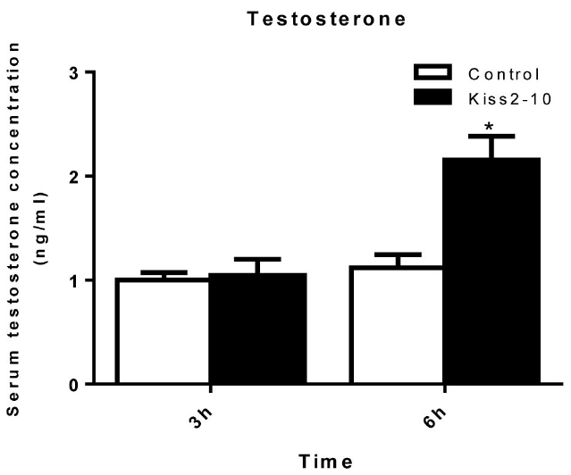
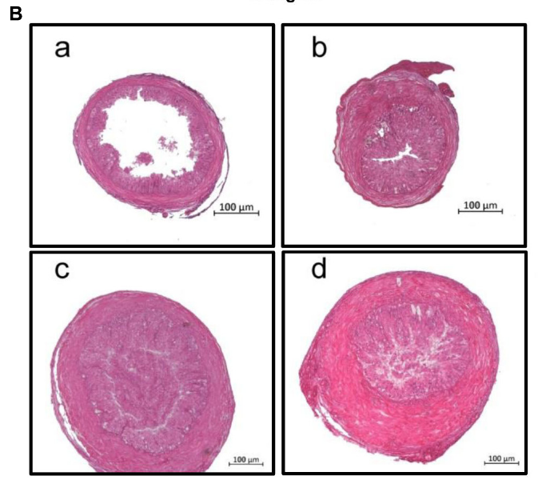
Kiss2 administration raises circulating testosterone
Testosterone is a steroid hormone associated with reproductive physiology. Following Kiss2-10 administration, Zhang and colleagues collected blood from male lined seahorses at 3 and 6 hours and measured serum testosterone with an immunoassay. The saline-treated group provided the injection comparison.
Testosterone was elevated at 6 hours after peptide treatment. The same experimental series found increased pituitary gonadotropin transcripts, connecting the administered peptide to changes at more than one level of reproductive physiology.
The observations support endocrine responsiveness of mature males to Kiss2-10. A circulating hormone response and a tissue transcript response are different measurements, and their coordinated changes connect the identified peptide system to the reproductive axis.
Zhang et al. (2018), Fig. 9. Serum testosterone after Kiss2-10 administration.
Zhang et al. (2018), Fig. 6B(a–d). Testis histology from immaturity to maturity.
Zhang et al. (2018)
41
Notes:
• Testosterone is a steroid hormone associated with reproductive physiology. Following Kiss2-10 administration, Zhang and colleagues collected blood from male lined seahorses at 3 and 6 hours and measured serum testosterone with an immunoassay. The saline-treated group provided the injection comparison.
– An immunoassay estimates hormone concentration using antibody-based detection; the paper measured serum testosterone rather than testosterone synthesis directly in the testis.
• Testosterone was elevated at 6 hours after peptide treatment. The same experimental series found increased pituitary gonadotropin transcripts, connecting the administered peptide to changes at more than one level of reproductive physiology.
• The observations support endocrine responsiveness of mature males to Kiss2-10. A circulating hormone response and a tissue transcript response are different measurements, and their coordinated changes connect the identified peptide system to the reproductive axis.
References:
Huixian Zhang, Bo Zhang, Geng Qin, Shuisheng Li, Qiang Lin (2018). The Roles of the Kisspeptin System in the Reproductive Physiology of the Lined Seahorse (Hippocampus erectus), an Ovoviviparous Fish With Male Pregnancy. Frontiers in Neuroscience 12: 940. https://doi.org/10.3389/fnins.2018.00940
Figure: Zhang et al. (2018), Fig. 9. Serum testosterone after Kiss2-10 administration.
Figure source: https://doi.org/10.3389/fnins.2018.00940
Figure: Zhang et al. (2018), Fig. 6B(a–d). Testis histology from immaturity to maturity.
Figure source: https://doi.org/10.3389/fnins.2018.00940

Slide 42
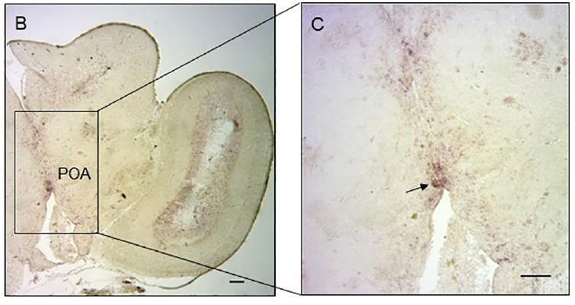
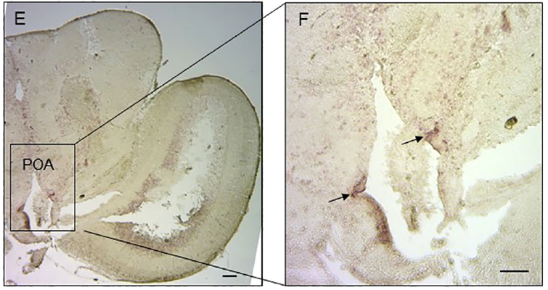
Vasotocin and isotocin occupy preoptic tissue
Vasotocin and isotocin are nine-amino-acid peptide hormones related to mammalian vasopressin and oxytocin. Zhang and colleagues cloned their precursors in lined seahorses and used in situ hybridization, a method detecting selected RNA sequences within tissue, to locate cells expressing the genes.
Both transcript signals occurred in the preoptic area, hypothalamic tissue associated with reproductive regulation. Vasotocin labeling was concentrated centrally, whereas isotocin labeling was more peripheral within the examined area. The preparations localized signaling-molecule transcripts to identifiable neural tissue.
The study also used a sense-probe control to assess nonspecific labeling. Transcript localization and the later vasotocin intervention supply complementary anatomical and physiological evidence for a seahorse neuroendocrine system.
Zhang et al. (2022), Fig. 4B–C. Vasotocin transcripts in the preoptic area.
Zhang et al. (2022), Fig. 4E–F. Isotocin transcripts in the preoptic area.
Zhang et al. (2022)
42
Notes:
• Vasotocin and isotocin are nine-amino-acid peptide hormones related to mammalian vasopressin and oxytocin. Zhang and colleagues cloned their precursors in lined seahorses and used in situ hybridization, a method detecting selected RNA sequences within tissue, to locate cells expressing the genes.
– Antisense probes bind the target transcript; the corresponding sense probe provides a control for labeling unrelated to that specific RNA sequence.
• Both transcript signals occurred in the preoptic area, hypothalamic tissue associated with reproductive regulation. Vasotocin labeling was concentrated centrally, whereas isotocin labeling was more peripheral within the examined area. The preparations localized signaling-molecule transcripts to identifiable neural tissue.
• The study also used a sense-probe control to assess nonspecific labeling. Transcript localization and the later vasotocin intervention supply complementary anatomical and physiological evidence for a seahorse neuroendocrine system.
References:
Huixian Zhang, Yali Liu, Geng Qin, Qiang Lin (2022). Identification of neurohypophysial hormones and the role of VT in the parturition of pregnant seahorses (Hippocampus erectus). Frontiers in Endocrinology 13: 923234. https://doi.org/10.3389/fendo.2022.923234
Figure: Zhang et al. (2022), Fig. 4B–C. Vasotocin transcripts in the preoptic area.
Figure source: https://doi.org/10.3389/fendo.2022.923234
Figure: Zhang et al. (2022), Fig. 4E–F. Isotocin transcripts in the preoptic area.
Figure source: https://doi.org/10.3389/fendo.2022.923234

Slide 43
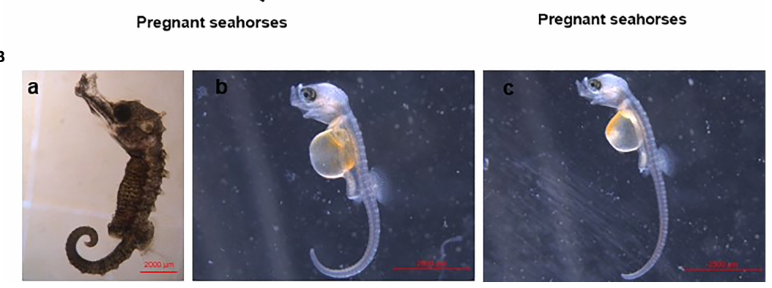
Vasotocin triggers premature release of young
Parturition is the release of offspring at the end of pregnancy. Zhang and colleagues injected pregnant lined seahorse males with vasotocin at 50 or 500 ng/g body mass and compared them with saline-injected controls. Treated males performed repeated body-swinging movements associated with birth.
The released young were premature: they were shorter and retained larger yolk sacs than normally released animals. Yolk is stored embryonic nutrition, and persistence of a large yolk sac identifies incomplete development at the time of release.
The peptide intervention therefore affected the timing of a reproductive behavior, not simply a molecular marker. Male seahorse birth combines bodily movement with an endocrine state that can be experimentally shifted by vasotocin administration.
Zhang et al. (2022), Fig. 5B(a–c). Normally released and prematurely released young.
Zhang et al. (2022)
43
Notes:
• Parturition is the release of offspring at the end of pregnancy. Zhang and colleagues injected pregnant lined seahorse males with vasotocin at 50 or 500 ng/g body mass and compared them with saline-injected controls. Treated males performed repeated body-swinging movements associated with birth.
– The photographs compare normally released young with young released after the lower and higher vasotocin doses; the dose units are amount per body mass.
• The released young were premature: they were shorter and retained larger yolk sacs than normally released animals. Yolk is stored embryonic nutrition, and persistence of a large yolk sac identifies incomplete development at the time of release.
• The peptide intervention therefore affected the timing of a reproductive behavior, not simply a molecular marker. Male seahorse birth combines bodily movement with an endocrine state that can be experimentally shifted by vasotocin administration.
References:
Huixian Zhang, Yali Liu, Geng Qin, Qiang Lin (2022). Identification of neurohypophysial hormones and the role of VT in the parturition of pregnant seahorses (Hippocampus erectus). Frontiers in Endocrinology 13: 923234. https://doi.org/10.3389/fendo.2022.923234
Figure: Zhang et al. (2022), Fig. 5B(a–c). Normally released and prematurely released young.
Figure source: https://doi.org/10.3389/fendo.2022.923234

Slide 44
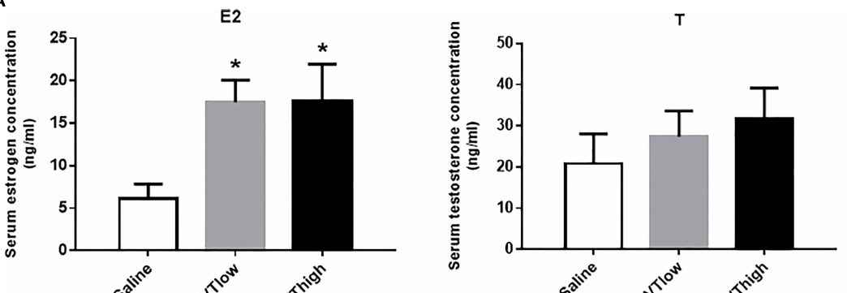
Vasotocin changes reproductive endocrine state
Six hours after vasotocin administration, pregnant lined seahorses had increased circulating estrogen, while testosterone remained similar to the control condition. Estrogen is a steroid hormone participating in reproductive regulation. Zhang and colleagues measured the circulating hormones separately from tissue transcripts.
Pituitary FSHβ and LHβ transcripts increased, while prolactin transcripts decreased. Prolactin is a pituitary hormone discussed in the source in relation to incubation physiology. Vasotocin therefore shifted several components of the reproductive endocrine state alongside the observed birth behavior.
The authors proposed a reproductive-axis mechanism linking neuropeptide action, gonadotropin regulation, and estrogen-associated responses. The combined intervention and endocrine measurements identify a coordinated response rather than requiring every hormone to change in the same direction.
Zhang et al. (2022), Fig. 5A. Circulating estrogen and testosterone after vasotocin.
Senarat et al. (2020), Fig. 27. Neural and glandular regions of the pituitary.
Zhang et al. (2022); Senarat et al. (2020)
44
Notes:
• Six hours after vasotocin administration, pregnant lined seahorses had increased circulating estrogen, while testosterone remained similar to the control condition. Estrogen is a steroid hormone participating in reproductive regulation. Zhang and colleagues measured the circulating hormones separately from tissue transcripts.
– The paper measured transcript responses and serum steroids; a complete sequence of intervening cellular events was not recorded.
• Pituitary FSHβ and LHβ transcripts increased, while prolactin transcripts decreased. Prolactin is a pituitary hormone discussed in the source in relation to incubation physiology. Vasotocin therefore shifted several components of the reproductive endocrine state alongside the observed birth behavior.
• The authors proposed a reproductive-axis mechanism linking neuropeptide action, gonadotropin regulation, and estrogen-associated responses. The combined intervention and endocrine measurements identify a coordinated response rather than requiring every hormone to change in the same direction.
References:
Huixian Zhang, Yali Liu, Geng Qin, Qiang Lin (2022). Identification of neurohypophysial hormones and the role of VT in the parturition of pregnant seahorses (Hippocampus erectus). Frontiers in Endocrinology 13: 923234. https://doi.org/10.3389/fendo.2022.923234
Sinlapachai Senarat, Jes Kettratad, Gen Kaneko, Thatpon Kamnurdnin, Chanyut Sudtongkong (2020). The microanatomy of the central nervous system and brain of the Indo-Pacific seahorse, Hippocampus barbouri, during development. Zoologia 37: e53734, 1–11. https://doi.org/10.3897/zoologia.37.e53734
Figure: Zhang et al. (2022), Fig. 5A. Circulating estrogen and testosterone after vasotocin.
Figure source: https://doi.org/10.3389/fendo.2022.923234
Figure: Senarat et al. (2020), Fig. 27. Neural and glandular regions of the pituitary.
Figure source: https://doi.org/10.3897/zoologia.37.e53734

Slide 45
Pregnancy and birth involve distinct peptide responses
Male seahorse reproduction includes transitions into pregnancy and into birth, with different peptide-associated responses. Zhang and colleagues found reduced Kiss2 and receptor transcripts during pregnancy, followed by recovery after parturition. A separate vasotocin experiment shifted pregnant males toward premature release.
Reproductive state therefore changes both the molecular background and the response to a supplied signal. Kiss2 measurements describe stage-associated regulation, whereas vasotocin administration directly changes the timing of bodily birth behavior. The experimental designs address different parts of the cycle.
The released offspring begin visually guided feeding while their own sensory, neural, and skeletal systems continue developing. Parental endocrine timing and offspring developmental readiness meet at birth, linking adult reproductive control to juvenile behavioral independence.
Zhang et al. (2018), Fig. 7. Kiss2 and receptor expression across pregnancy stages.
Zhang et al. (2022), Fig. 5B(a–c). Normally released and prematurely released young.
Zhang et al. (2018); Zhang et al. (2022)
45
Notes:
• Male seahorse reproduction includes transitions into pregnancy and into birth, with different peptide-associated responses. Zhang and colleagues found reduced Kiss2 and receptor transcripts during pregnancy, followed by recovery after parturition. A separate vasotocin experiment shifted pregnant males toward premature release.
– The two peptide studies should not be presented as a single proven linear pathway; they tested separate components of the male reproductive cycle.
• Reproductive state therefore changes both the molecular background and the response to a supplied signal. Kiss2 measurements describe stage-associated regulation, whereas vasotocin administration directly changes the timing of bodily birth behavior. The experimental designs address different parts of the cycle.
• The released offspring begin visually guided feeding while their own sensory, neural, and skeletal systems continue developing. Parental endocrine timing and offspring developmental readiness meet at birth, linking adult reproductive control to juvenile behavioral independence.
References:
Huixian Zhang, Bo Zhang, Geng Qin, Shuisheng Li, Qiang Lin (2018). The Roles of the Kisspeptin System in the Reproductive Physiology of the Lined Seahorse (Hippocampus erectus), an Ovoviviparous Fish With Male Pregnancy. Frontiers in Neuroscience 12: 940. https://doi.org/10.3389/fnins.2018.00940
Huixian Zhang, Yali Liu, Geng Qin, Qiang Lin (2022). Identification of neurohypophysial hormones and the role of VT in the parturition of pregnant seahorses (Hippocampus erectus). Frontiers in Endocrinology 13: 923234. https://doi.org/10.3389/fendo.2022.923234
Figure: Zhang et al. (2018), Fig. 7. Kiss2 and receptor expression across pregnancy stages.
Figure source: https://doi.org/10.3389/fnins.2018.00940
Figure: Zhang et al. (2022), Fig. 5B(a–c). Normally released and prematurely released young.
Figure source: https://doi.org/10.3389/fendo.2022.923234

Slide 46
Key takeaways
Early sensory competence Newborn lined seahorses capture live prey while retinal organization is already recognizable and snout ossification continues.
Layered neural organization The prominent optic tectum and three-layered cerebellum differentiate during postnatal development.
Approach and strike A slow approach and quiet water region limit prey warning; a close-range pivot strike can reach prey in less than 1 ms.
Partner-associated brightening Lined seahorses change abdominal luminance more strongly during familiar partner interactions, with most display events performed by males.
Kisspeptin endocrine responsiveness Kiss2-10 administration increases pituitary gonadotropin transcripts and later circulating testosterone in mature males.
Neuroendocrine birth timing Vasotocin administration induces premature offspring release and changes estrogen and pituitary transcript responses in pregnant males.
Senarat et al. (2020); Sun et al. (2021); Gemmell et al. (2013); Mederos et al. (2022); Zhang et al. (2018); Zhang et al. (2022)
46
Notes:
Sinlapachai Senarat, Jes Kettratad, Gen Kaneko, Thatpon Kamnurdnin, Chanyut Sudtongkong (2020). The microanatomy of the central nervous system and brain of the Indo-Pacific seahorse, Hippocampus barbouri, during development. Zoologia 37: e53734, 1–11. https://doi.org/10.3897/zoologia.37.e53734
Jinhui Sun, Bo Zhang, Shangduan Xie, Honghao Zhao, Yanjing Yang, Pei Cui, Xiaohan Yu, Sudong Xia, Qiang Lin, Geng Qin (2021). Kinematics of prey capture and histological development of related organs in juvenile seahorse. Aquaculture 541: 736732. https://doi.org/10.1016/j.aquaculture.2021.736732
Brad J. Gemmell, Jian Sheng, Edward J. Buskey (2013). Morphology of seahorse head hydrodynamically aids in capture of evasive prey. Nature Communications 4: 2840. https://doi.org/10.1038/ncomms3840
Sabrina L. Mederos, Rafael C. Duarte, Mira Mastoras, Megan Y. Dennis, Matthew L. Settles, Allison R. Lau, Alexandria Scott, Kacie Woodward, Colby Johnson, Adele M. H. Seelke, Karen L. Bales (2022). Effects of pairing on color change and central gene expression in lined seahorses. Genes, Brain and Behavior 21: e12812. https://doi.org/10.1111/gbb.12812
Huixian Zhang, Bo Zhang, Geng Qin, Shuisheng Li, Qiang Lin (2018). The Roles of the Kisspeptin System in the Reproductive Physiology of the Lined Seahorse (Hippocampus erectus), an Ovoviviparous Fish With Male Pregnancy. Frontiers in Neuroscience 12: 940. https://doi.org/10.3389/fnins.2018.00940
Huixian Zhang, Yali Liu, Geng Qin, Qiang Lin (2022). Identification of neurohypophysial hormones and the role of VT in the parturition of pregnant seahorses (Hippocampus erectus). Frontiers in Endocrinology 13: 923234. https://doi.org/10.3389/fendo.2022.923234

