Slide 1
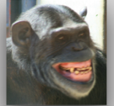
NEUR 411 · NEUROETHOLOGY · FALL 2026
Lecture 93
Evolution of language:
primate communication, neural pathways for vocal and gestural control, and evidence for language origins in early humans
Date TBD
Jordan Lopez, Ph.D.
Professor of Neurobiology & Biomedical Engineering
Oña et al. (2019), Fig. 1, bared-teeth face. Chimpanzee facial signal.
Notes:
Evolution of language: primate communication, neural pathways for vocal and gestural control, and evidence for language origins in early humans
Lecture 93. NEUR 411 · NEUROETHOLOGY · FALL 2026. Date TBD.
Figure: Oña et al. (2019), Fig. 1, bared-teeth face. Chimpanzee facial signal.
Figure source: https://doi.org/10.7717/peerj.7623
References:
Oña LS, Sandler W, Liebal K (2019). A stepping stone to compositionality in chimpanzee communication. PeerJ 7:e7623. https://doi.org/10.7717/peerj.7623

Slide 2
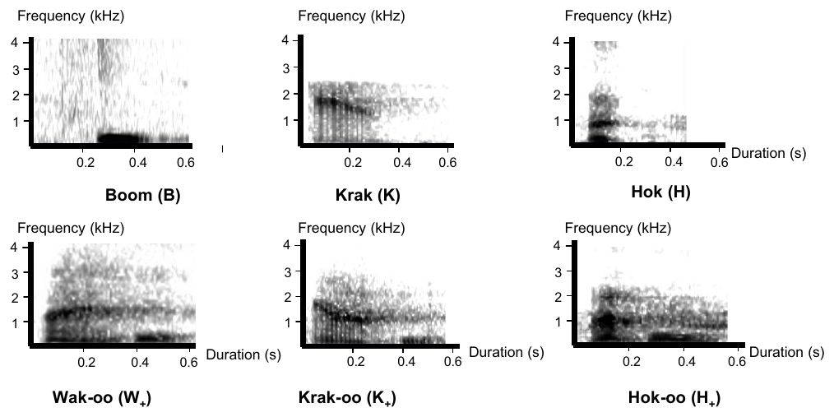
Campbell's monkey calls distinguish events
Communication occurs when a signal influences another individual's behavior. Male Campbell's monkeys produce several loud call types during disturbances in their forest environment. Ouattara and colleagues recorded naturally occurring events and presented predator-related stimuli to compare vocal responses across contexts.
A spectrogram represents sound energy across time and frequency. The published recordings distinguish boom, krak and hok calls and forms containing an additional terminal sound. Calls differ in acoustic structure as well as their distribution during leopard-related, eagle-related and less specific disturbances.
Context-linked production supplies evidence about the information a call can provide. A call associated with an eagle is not automatically a word with the same semantic and grammatical properties as a human noun. Production context and receiver interpretation are distinct experimental questions.
Ouattara et al. (2009), Fig. 1. Spectrograms of the six male call types
Ouattara et al. (2009)
02
Notes:
• **Communication** occurs when a signal influences another individual's behavior. Male Campbell's monkeys produce several loud call types during disturbances in their forest environment. Ouattara and colleagues recorded naturally occurring events and presented predator-related stimuli to compare vocal responses across contexts.
• A **spectrogram** represents sound energy across time and frequency. The published recordings distinguish boom, krak and hok calls and forms containing an additional terminal sound. Calls differ in acoustic structure as well as their distribution during leopard-related, eagle-related and less specific disturbances.
• Context-linked production supplies evidence about the information a call can provide. A call associated with an eagle is not automatically a word with the same semantic and grammatical properties as a human noun. Production context and receiver interpretation are distinct experimental questions.
References:
Ouattara K, Lemasson A, Zuberbühler K (2009). Campbell's monkeys concatenate vocalizations into context-specific call sequences. Proceedings of the National Academy of Sciences of the United States of America 106:22026-22031. https://doi.org/10.1073/pnas.0908118106
Figure: Ouattara et al. (2009), Fig. 1. Spectrograms of the six male call types
Figure source: https://doi.org/10.1073/pnas.0908118106

Slide 3
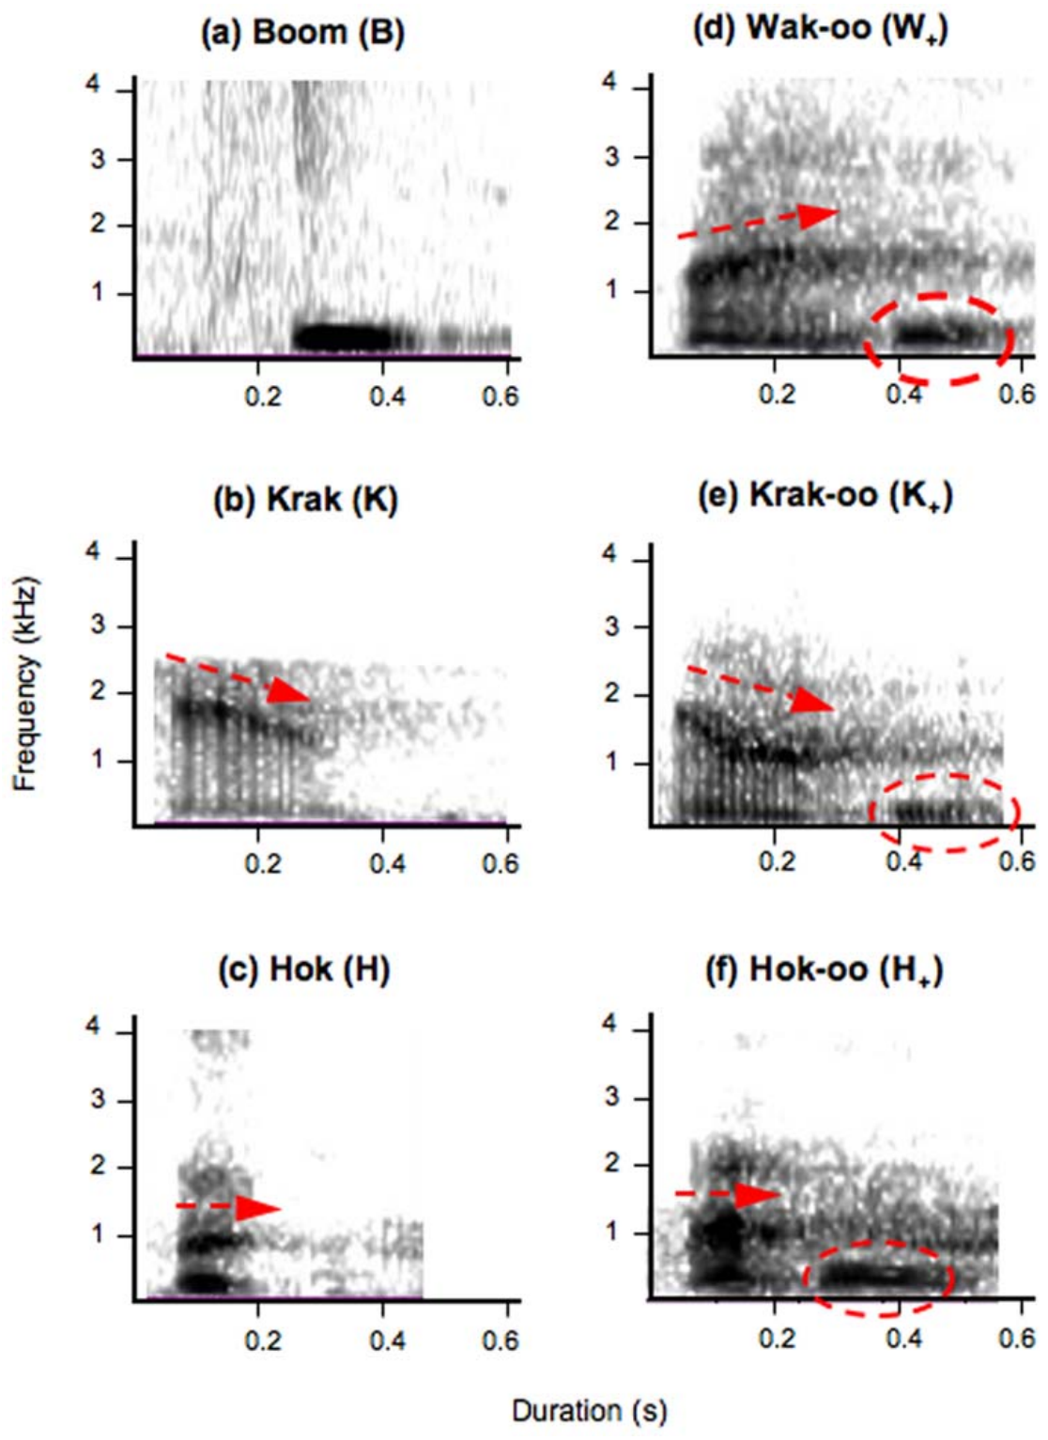
A terminal sound changes the distribution of calls
An affix is an element attached to another signal. Campbell's monkeys sometimes add an acoustically recognizable “oo” element after a krak or hok call. The resulting krak-oo and hok-oo forms retain the initial call structure while adding a terminal component.
Unmodified krak calls were closely associated with leopard-related danger. Krak-oo calls occurred across a broader set of disturbances. Hok and hok-oo also differed in their contextual distribution, with the suffixed form extending beyond the narrower circumstances associated with the unsuffixed call.
The recurring terminal element and broader contexts support a modifier-like interpretation of the acoustic addition. This comparison concerns naturally produced signals and their contexts. Human affixation includes grammatical operations that require separate evidence; the shared label does not establish equivalent grammar.
Ouattara et al. (2009), Fig. 1. Original calls and their suffixed forms
Ouattara et al. (2009)
03
Notes:
• An **affix** is an element attached to another signal. Campbell's monkeys sometimes add an acoustically recognizable “oo” element after a krak or hok call. The resulting krak-oo and hok-oo forms retain the initial call structure while adding a terminal component.
• Unmodified krak calls were closely associated with leopard-related danger. Krak-oo calls occurred across a broader set of disturbances. Hok and hok-oo also differed in their contextual distribution, with the suffixed form extending beyond the narrower circumstances associated with the unsuffixed call.
• The recurring terminal element and broader contexts support a modifier-like interpretation of the acoustic addition. This comparison concerns naturally produced signals and their contexts. Human affixation includes grammatical operations that require separate evidence; the shared label does not establish equivalent grammar.
References:
Ouattara K, Lemasson A, Zuberbühler K (2009). Campbell's monkeys use affixation to alter call meaning. PloS one 4:e7808. https://doi.org/10.1371/journal.pone.0007808
Figure: Ouattara et al. (2009), Fig. 1. Original calls and their suffixed forms
Figure source: https://doi.org/10.1371/journal.pone.0007808

Slide 4
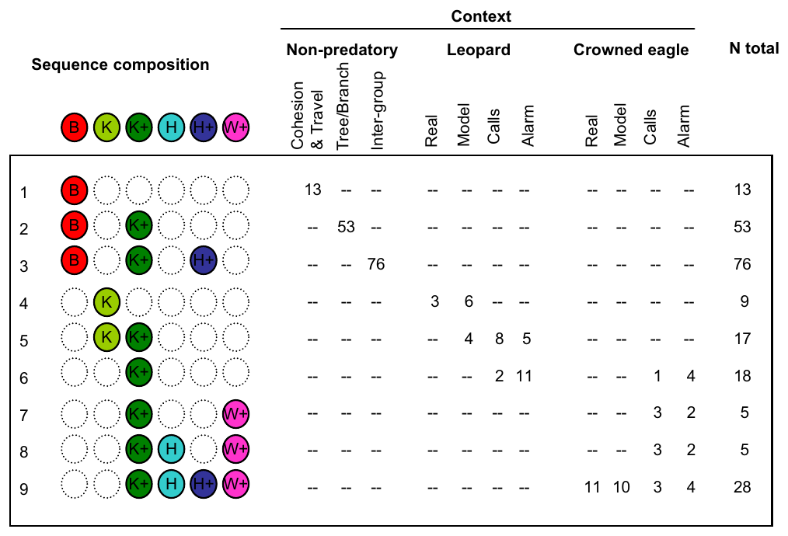
Call order preserves information about the situation
A sequence contains multiple signals produced in a particular order. Campbell's monkey males did not combine their call types randomly. The composition of longer sequences differed during nonpredatory disturbances, leopard encounters and eagle encounters.
Boom calls could precede other components in sequences associated with comparatively benign events. Predator-related sequences contained different proportions and arrangements of krak, hok and their suffixed forms. The same inventory therefore supported several context-linked patterns rather than a separate acoustic signal for every event.
Order and recombination are components of structured communication. Their presence establishes constraints on signal production, but a finite collection of recurring patterns is compatible with several mechanisms. Claims about sentence-like syntax require evidence about combination meaning and how receivers respond to controlled changes in order.
Ouattara et al. (2009), Fig. 2. Call-sequence composition across behavioral contexts
Ouattara et al. (2009)
04
Notes:
• A **sequence** contains multiple signals produced in a particular order. Campbell's monkey males did not combine their call types randomly. The composition of longer sequences differed during nonpredatory disturbances, leopard encounters and eagle encounters.
• Boom calls could precede other components in sequences associated with comparatively benign events. Predator-related sequences contained different proportions and arrangements of krak, hok and their suffixed forms. The same inventory therefore supported several context-linked patterns rather than a separate acoustic signal for every event.
• Order and recombination are components of structured communication. Their presence establishes constraints on signal production, but a finite collection of recurring patterns is compatible with several mechanisms. Claims about sentence-like syntax require evidence about combination meaning and how receivers respond to controlled changes in order.
References:
Ouattara K, Lemasson A, Zuberbühler K (2009). Campbell's monkeys concatenate vocalizations into context-specific call sequences. Proceedings of the National Academy of Sciences of the United States of America 106:22026-22031. https://doi.org/10.1073/pnas.0908118106
Figure: Ouattara et al. (2009), Fig. 2. Call-sequence composition across behavioral contexts
Figure source: https://doi.org/10.1073/pnas.0908118106

Slide 5
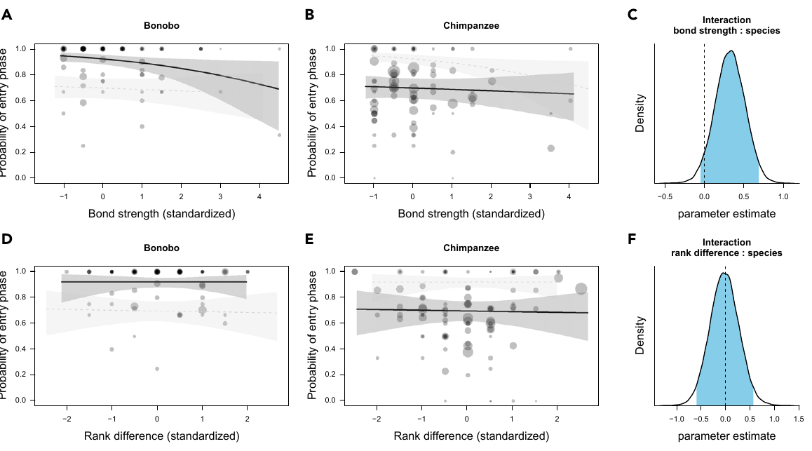
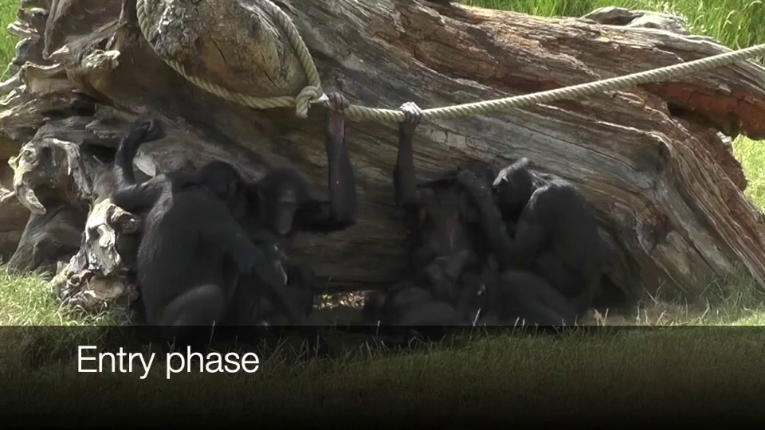
Apes negotiate entry into shared activities
Joint action is an activity organized through the coordinated behavior of two or more individuals. Heesen and colleagues examined chimpanzee and bonobo grooming and play, coding how partners entered an interaction rather than considering only behavior after the activity had begun.
An entry phase could contain mutual gaze, gestures and other signals before sustained grooming or play. These behaviors established orientation toward a partner and readiness to engage. The researchers distinguished communicative entry from simply being near another animal or beginning an action without an exchange.
In Video S1, bonobos exchange gaze and gestures during a 39.7 s entry phase before grooming begins. Coordinated entry provides a behavioral comparison with the management of human conversation. The authors' process-based account of joint commitment concerns observable coordination; attributing a human-like sense of obligation requires additional evidence.
Heesen et al. (2021), Fig. 1. Entry-phase occurrence across relationships
Click video to play in Slide Show. Heesen et al. (2021), Video S1. Bonobos use gaze and gesture during a 39.7 s grooming entry phase..
Heesen et al. (2021)
05
Notes:
• **Joint action** is an activity organized through the coordinated behavior of two or more individuals. Heesen and colleagues examined chimpanzee and bonobo grooming and play, coding how partners entered an interaction rather than considering only behavior after the activity had begun.
• An entry phase could contain mutual gaze, gestures and other signals before sustained grooming or play. These behaviors established orientation toward a partner and readiness to engage. The researchers distinguished communicative entry from simply being near another animal or beginning an action without an exchange.
• In Video S1, bonobos exchange gaze and gestures during a **39.7 s** entry phase before grooming begins. Coordinated entry provides a behavioral comparison with the management of human conversation. The authors' process-based account of joint commitment concerns observable coordination; attributing a human-like sense of obligation requires additional evidence.
References:
Heesen R, Bangerter A, Zuberbühler K, Iglesias K, Neumann C, Pajot A, Perrenoud L, Guéry JP, Rossano F, Genty E (2021). Assessing joint commitment as a process in great apes. iScience 24:102872. https://doi.org/10.1016/j.isci.2021.102872
Figure: Heesen et al. (2021), Fig. 1. Entry-phase occurrence across relationships
Figure source: https://doi.org/10.1016/j.isci.2021.102872
Article-provided recording: Heesen et al. (2021), Video S1. Bonobos use gaze and gesture during a 39.7 s grooming entry phase..
• Bonobos use gaze and gesture during a 39.7 s grooming entry phase. Original audio is preserved.
Article DOI: https://doi.org/10.1016/j.isci.2021.102872
Original media URL: https://pmc-oa-opendata.s3.amazonaws.com/PMC8390869.1/mmc2.mp4
Credit: Raphaela Heesen and Emilie Genty; Heesen R, Bangerter A, Zuberbühler K, Iglesias K, Neumann C, Pajot A, Perrenoud L, Guéry JP, Rossano F, Genty E (2021). Assessing joint commitment as a process in great apes. iScience 24:102872. https://doi.org/10.1016/j.isci.2021.102872
License: © 2021 The Authors This is an open access article under the CC BY license (http://creativecommons.org/licenses/by/4.0/).
Compatibility: Original publisher MP4 retained byte for byte: H.264/yuv420p video and AAC audio; no conversion or scientific editing.
Playback: click the recording in PowerPoint Slide Show. The credited original article figure remains a static fallback. Full media decode and embedded relationships were checked; interactive PowerPoint playback was unavailable in this environment.

Slide 6
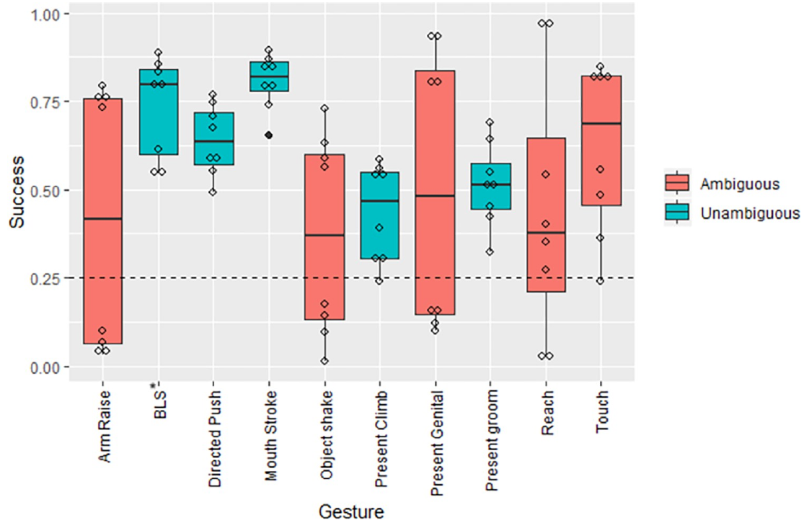
Humans identify meanings of unfamiliar ape gestures
A gesture is a bodily action used to influence a recipient. Graham and Hobaiter presented videos of chimpanzee and bonobo gestures to adults without specialist ape-gesture experience. Viewers selected the intended outcome from alternative descriptions rather than naming a visible movement.
Participants identified gesture meanings above the level expected from random choices. Many gestures were linked to everyday social outcomes such as approaching, moving away, initiating grooming or requesting an object. Success varied across gesture types rather than being uniform across the repertoire.
Shared recognition is compatible with continuity in ape communication, but the experiment tested contemporary human interpretation of recorded behavior. It did not reconstruct an ancestral vocabulary. The alternatives, visible interaction and participants' broader experience with human action all contribute to the interpretation task.
Graham & Hobaiter (2023), Fig. 1. Response accuracy across ape gesture types
Graham & Hobaiter (2023)
06
Notes:
• A **gesture** is a bodily action used to influence a recipient. Graham and Hobaiter presented videos of chimpanzee and bonobo gestures to adults without specialist ape-gesture experience. Viewers selected the intended outcome from alternative descriptions rather than naming a visible movement.
• Participants identified gesture meanings above the level expected from random choices. Many gestures were linked to everyday social outcomes such as approaching, moving away, initiating grooming or requesting an object. Success varied across gesture types rather than being uniform across the repertoire.
• Shared recognition is compatible with continuity in ape communication, but the experiment tested contemporary human interpretation of recorded behavior. It did not reconstruct an ancestral vocabulary. The alternatives, visible interaction and participants' broader experience with human action all contribute to the interpretation task.
References:
Graham KE, Hobaiter C (2023). Towards a great ape dictionary: Inexperienced humans understand common nonhuman ape gestures. PLoS biology 21:e3001939. https://doi.org/10.1371/journal.pbio.3001939
Figure: Graham & Hobaiter (2023), Fig. 1. Response accuracy across ape gesture types
Figure source: https://doi.org/10.1371/journal.pbio.3001939

Slide 7
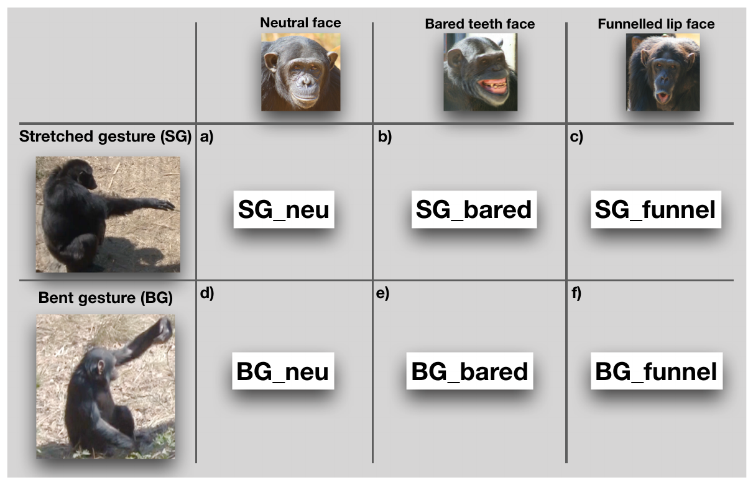
Chimpanzees combine facial and manual signals
Multimodal communication combines information carried by different sensory or motor channels. Oña and colleagues coded chimpanzee gestures together with accompanying facial expressions during social interactions. Facial categories included neutral, bared-teeth and funnel-shaped configurations.
A stretched arm or bent-arm action could occur with different facial configurations. The study retained the form of each component instead of treating every combination as an unrelated gesture. Responses were classified using the recipient's ensuing behavior and the social context of the exchange.
Joint production creates an opportunity for one component to alter the interpretation of another. A facial expression can change the social significance of a similar arm movement without requiring a spoken word. The critical comparison is between the recipient's responses to combinations and responses to their component signals.
Oña et al. (2019), Fig. 1. Published photographs of gestures and facial expressions
Oña et al. (2019)
07
Notes:
• **Multimodal communication** combines information carried by different sensory or motor channels. Oña and colleagues coded chimpanzee gestures together with accompanying facial expressions during social interactions. Facial categories included neutral, bared-teeth and funnel-shaped configurations.
• A stretched arm or bent-arm action could occur with different facial configurations. The study retained the form of each component instead of treating every combination as an unrelated gesture. Responses were classified using the recipient's ensuing behavior and the social context of the exchange.
• Joint production creates an opportunity for one component to alter the interpretation of another. A facial expression can change the social significance of a similar arm movement without requiring a spoken word. The critical comparison is between the recipient's responses to combinations and responses to their component signals.
References:
Oña LS, Sandler W, Liebal K (2019). A stepping stone to compositionality in chimpanzee communication. PeerJ 7:e7623. https://doi.org/10.7717/peerj.7623
Figure: Oña et al. (2019), Fig. 1. Published photographs of gestures and facial expressions
Figure source: https://doi.org/10.7717/peerj.7623

Slide 8
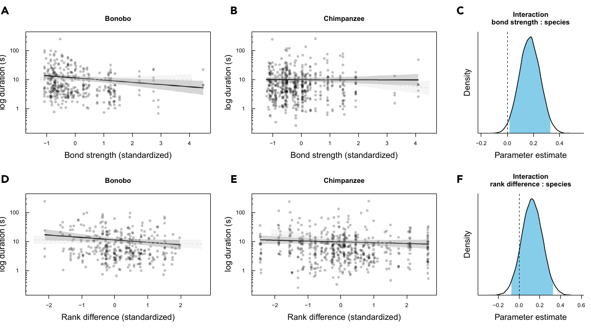
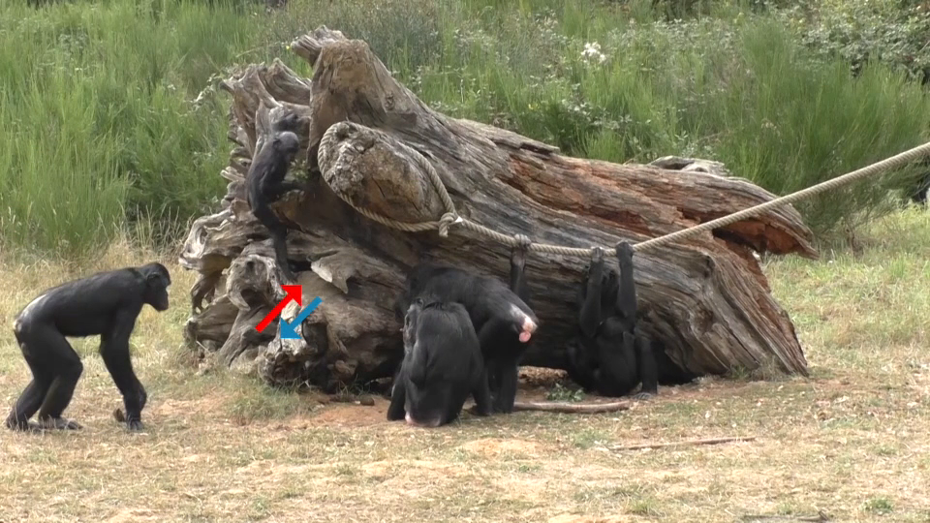
Gaze and gesture organize social participation
Mutual gaze occurs when interaction partners look toward one another. In the ape study, gaze was coded together with gestures during entry into joint activities. A communicative exchange could contain multiple actions, allowing the behavior of one partner to influence the next action of the other.
Grooming and play require different physical arrangements. Partners must gain access to a body surface or establish a compatible play posture. The original recording permits these adjustments to be evaluated as part of an unfolding interaction rather than as isolated still-frame gestures.
Video S2 records a 2.9 s bonobo entry phase consisting of mutual gaze before grooming, without a gesture exchange. The frequency and duration of entry exchanges differed with species and relationship variables. Comparing these phases identifies social coordination shared across apes while retaining differences in how strongly relationships shape its expression.
Heesen et al. (2021), Fig. 3. Entry-phase duration across relationships
Click video to play in Slide Show. Heesen et al. (2021), Video S2. Bonobos begin grooming after a 2.9 s mutual-gaze entry, without gesture exchange..
Heesen et al. (2021)
08
Notes:
• **Mutual gaze** occurs when interaction partners look toward one another. In the ape study, gaze was coded together with gestures during entry into joint activities. A communicative exchange could contain multiple actions, allowing the behavior of one partner to influence the next action of the other.
• Grooming and play require different physical arrangements. Partners must gain access to a body surface or establish a compatible play posture. The original recording permits these adjustments to be evaluated as part of an unfolding interaction rather than as isolated still-frame gestures.
• Video S2 records a **2.9 s** bonobo entry phase consisting of mutual gaze before grooming, without a gesture exchange. The frequency and duration of entry exchanges differed with species and relationship variables. Comparing these phases identifies social coordination shared across apes while retaining differences in how strongly relationships shape its expression.
References:
Heesen R, Bangerter A, Zuberbühler K, Iglesias K, Neumann C, Pajot A, Perrenoud L, Guéry JP, Rossano F, Genty E (2021). Assessing joint commitment as a process in great apes. iScience 24:102872. https://doi.org/10.1016/j.isci.2021.102872
Figure: Heesen et al. (2021), Fig. 3. Entry-phase duration across relationships
Figure source: https://doi.org/10.1016/j.isci.2021.102872
Article-provided recording: Heesen et al. (2021), Video S2. Bonobos begin grooming after a 2.9 s mutual-gaze entry, without gesture exchange..
• Bonobos begin grooming after a 2.9 s mutual-gaze entry, without gesture exchange. Original audio is preserved.
Article DOI: https://doi.org/10.1016/j.isci.2021.102872
Original media URL: https://pmc-oa-opendata.s3.amazonaws.com/PMC8390869.1/mmc3.mp4
Credit: Raphaela Heesen and Emilie Genty; Heesen R, Bangerter A, Zuberbühler K, Iglesias K, Neumann C, Pajot A, Perrenoud L, Guéry JP, Rossano F, Genty E (2021). Assessing joint commitment as a process in great apes. iScience 24:102872. https://doi.org/10.1016/j.isci.2021.102872
License: © 2021 The Authors This is an open access article under the CC BY license (http://creativecommons.org/licenses/by/4.0/).
Compatibility: Original publisher MP4 retained byte for byte: H.264/yuv420p video and AAC audio; no conversion or scientific editing.
Playback: click the recording in PowerPoint Slide Show. The credited original article figure remains a static fallback. Full media decode and embedded relationships were checked; interactive PowerPoint playback was unavailable in this environment.

Slide 9
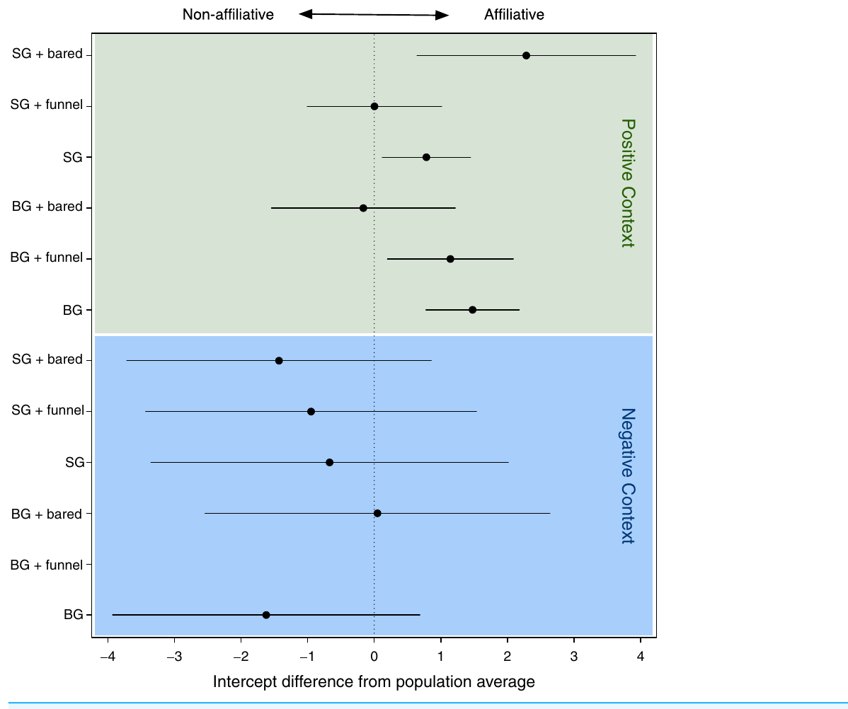
Signal combinations alter recipient responses
Compositionality means that the interpretation of a combination depends systematically on its components and their relationship. Chimpanzee facial and gestural combinations were associated with recipient responses that depended on social context and the accompanying facial expression.
The analysis compared interactions assigned positive and negative social valence. Valence describes whether an interaction was affiliative or antagonistic. The same broad gesture category could carry different consequences when paired with a different expression or produced within a different interaction.
Context sensitivity and interaction between components provide a possible precursor to richer combinatorial communication. The observed exchanges were not an experimental demonstration of unlimited sentence production. The measured result concerns the response patterns of chimpanzees to naturally occurring combinations of bodily signals.
Oña et al. (2019), Fig. 3. Recipient-response relationships across interaction contexts
Oña et al. (2019)
09
Notes:
• **Compositionality** means that the interpretation of a combination depends systematically on its components and their relationship. Chimpanzee facial and gestural combinations were associated with recipient responses that depended on social context and the accompanying facial expression.
• The analysis compared interactions assigned positive and negative social valence. Valence describes whether an interaction was affiliative or antagonistic. The same broad gesture category could carry different consequences when paired with a different expression or produced within a different interaction.
• Context sensitivity and interaction between components provide a possible precursor to richer combinatorial communication. The observed exchanges were not an experimental demonstration of unlimited sentence production. The measured result concerns the response patterns of chimpanzees to naturally occurring combinations of bodily signals.
References:
Oña LS, Sandler W, Liebal K (2019). A stepping stone to compositionality in chimpanzee communication. PeerJ 7:e7623. https://doi.org/10.7717/peerj.7623
Figure: Oña et al. (2019), Fig. 3. Recipient-response relationships across interaction contexts
Figure source: https://doi.org/10.7717/peerj.7623

Slide 10
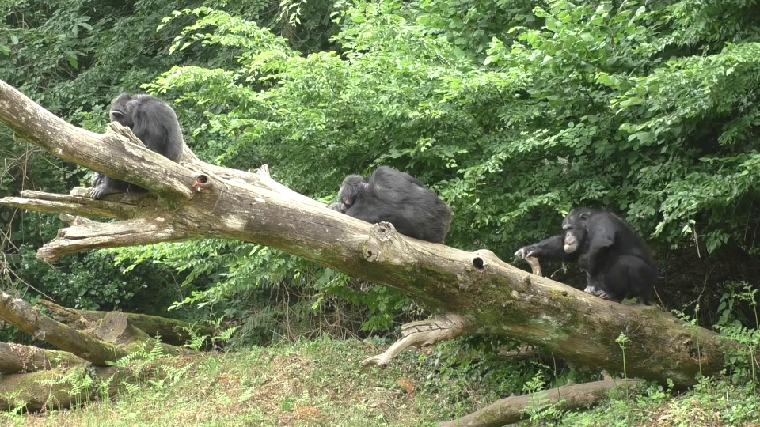
Partners maintain coordinated grooming and play
A joint-activity phase is the interval during which partners sustain a shared activity after entry. Ape grooming involves directed contact with another animal's body; social play involves reciprocal movements whose consequences depend on the partner's responses.
The study separated the ongoing activity from signals occurring before or after it. This distinction prevents every movement during grooming from being classified as a negotiation to begin. Video S3 records chimpanzees beginning grooming without mutual gaze or a communicative entry exchange, providing a contrast with negotiated entry.
A partner's orientation and movements provide information about whether participation continues. Such coordination is relevant to the social foundations of turn-taking because an action is regulated in relation to another individual's behavior. It is not evidence that apes produce the propositional commitments expressed in human conversation.
Heesen et al. (2021), Fig. 1. Entry-phase occurrence and absent-entry comparisons
Click video to play in Slide Show. Heesen et al. (2021), Video S3. Chimpanzees begin grooming without mutual gaze or a communicative entry exchange..
Heesen et al. (2021)
10
Notes:
• A **joint-activity phase** is the interval during which partners sustain a shared activity after entry. Ape grooming involves directed contact with another animal's body; social play involves reciprocal movements whose consequences depend on the partner's responses.
• The study separated the ongoing activity from signals occurring before or after it. This distinction prevents every movement during grooming from being classified as a negotiation to begin. Video S3 records chimpanzees beginning grooming without mutual gaze or a communicative entry exchange, providing a contrast with negotiated entry.
• A partner's orientation and movements provide information about whether participation continues. Such coordination is relevant to the social foundations of turn-taking because an action is regulated in relation to another individual's behavior. It is not evidence that apes produce the propositional commitments expressed in human conversation.
References:
Heesen R, Bangerter A, Zuberbühler K, Iglesias K, Neumann C, Pajot A, Perrenoud L, Guéry JP, Rossano F, Genty E (2021). Assessing joint commitment as a process in great apes. iScience 24:102872. https://doi.org/10.1016/j.isci.2021.102872
Figure: Heesen et al. (2021), Fig. 1. Entry-phase occurrence and absent-entry comparisons
Figure source: https://doi.org/10.1016/j.isci.2021.102872
Article-provided recording: Heesen et al. (2021), Video S3. Chimpanzees begin grooming without mutual gaze or a communicative entry exchange..
• Chimpanzees begin grooming without mutual gaze or a communicative entry exchange. Original audio is preserved.
Article DOI: https://doi.org/10.1016/j.isci.2021.102872
Original media URL: https://pmc-oa-opendata.s3.amazonaws.com/PMC8390869.1/mmc4.mp4
Credit: Raphaela Heesen and Emilie Genty; Heesen R, Bangerter A, Zuberbühler K, Iglesias K, Neumann C, Pajot A, Perrenoud L, Guéry JP, Rossano F, Genty E (2021). Assessing joint commitment as a process in great apes. iScience 24:102872. https://doi.org/10.1016/j.isci.2021.102872
License: © 2021 The Authors This is an open access article under the CC BY license (http://creativecommons.org/licenses/by/4.0/).
Compatibility: Original publisher MP4 retained byte for byte: H.264/yuv420p video and AAC audio; no conversion or scientific editing.
Playback: click the recording in PowerPoint Slide Show. The credited original article figure remains a static fallback. Full media decode and embedded relationships were checked; interactive PowerPoint playback was unavailable in this environment.

Slide 11
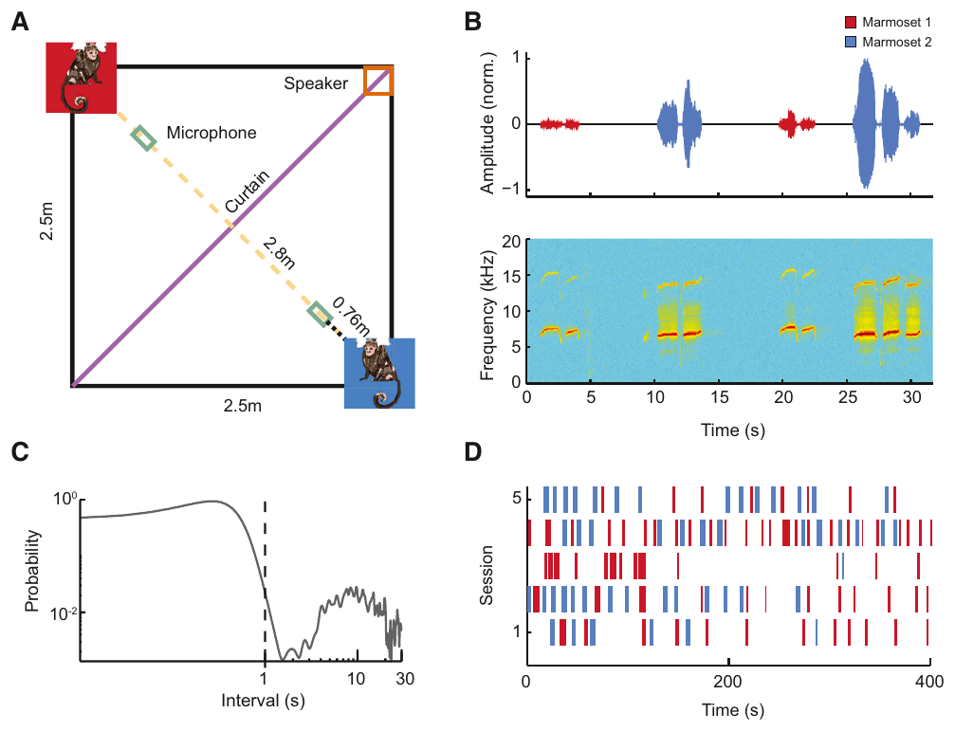
Marmosets exchange calls without visual contact
Vocal turn-taking is the alternation of calling between interaction partners. Takahashi and colleagues recorded common marmosets positioned on opposite sides of an opaque barrier. The animals could hear one another while direct visual exchanges were prevented.
A phee call is a long-distance contact vocalization with sustained tonal components. The study measured call timing during exchanges between marmosets and compared patterns across partner relationships. The acoustic recordings provided the timing of each animal's contributions over many successive turns.
Calls were coordinated rather than occurring as two independent streams. Turn-taking was not restricted to a single strongly bonded pair. The auditory-only preparation isolates coordination through acoustic information from immediate visual gestures, while leaving internal timing and auditory feedback as candidate components of the mechanism.
Takahashi et al. (2013), Fig. 1. Auditory-only apparatus and recorded vocal exchanges
Takahashi et al. (2013)
11
Notes:
• **Vocal turn-taking** is the alternation of calling between interaction partners. Takahashi and colleagues recorded common marmosets positioned on opposite sides of an opaque barrier. The animals could hear one another while direct visual exchanges were prevented.
• A **phee call** is a long-distance contact vocalization with sustained tonal components. The study measured call timing during exchanges between marmosets and compared patterns across partner relationships. The acoustic recordings provided the timing of each animal's contributions over many successive turns.
• Calls were coordinated rather than occurring as two independent streams. Turn-taking was not restricted to a single strongly bonded pair. The auditory-only preparation isolates coordination through acoustic information from immediate visual gestures, while leaving internal timing and auditory feedback as candidate components of the mechanism.
References:
Takahashi DY, Narayanan DZ, Ghazanfar AA (2013). Coupled oscillator dynamics of vocal turn-taking in monkeys. Current biology : CB 23:2162-2168. https://doi.org/10.1016/j.cub.2013.09.005
Figure: Takahashi et al. (2013), Fig. 1. Auditory-only apparatus and recorded vocal exchanges
Figure source: https://doi.org/10.1016/j.cub.2013.09.005

Slide 12
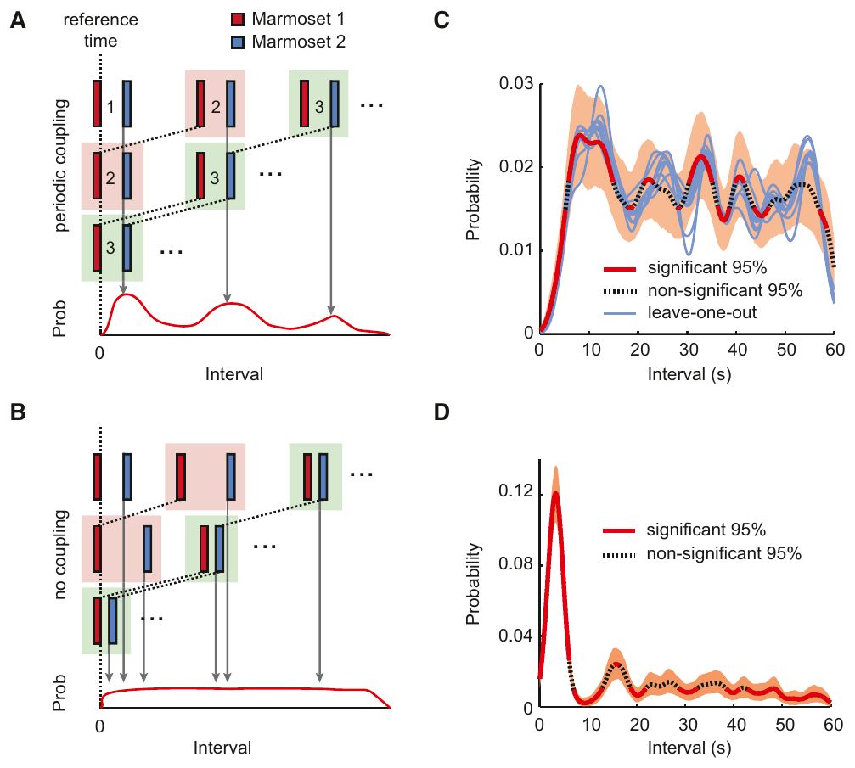
Calling rhythms become coupled between partners
An oscillator is a process that repeats through time. Coupled oscillators influence one another's timing. Marmoset call exchanges had recurring temporal structure, and a partner's call could shift the timing of the next contribution rather than simply triggering an immediate response.
The investigators compared alternative timing explanations and analyzed the relationship between call timing and the phase of the ongoing exchange. Their results supported coupled dynamics in which each animal's vocal rhythm was influenced by acoustic input from the other.
The oscillator description is a mathematical account of the observed timing. The experiment did not identify a particular neuronal pacemaker. Alternating calls establish a comparative basis for conversational timing, whereas the semantic content and flexible linguistic organization of human conversation require separate mechanisms and evidence.
Takahashi et al. (2013), Fig. 3. Periodic coupling in marmoset vocal exchanges
Takahashi et al. (2013)
12
Notes:
• An **oscillator** is a process that repeats through time. Coupled oscillators influence one another's timing. Marmoset call exchanges had recurring temporal structure, and a partner's call could shift the timing of the next contribution rather than simply triggering an immediate response.
• The investigators compared alternative timing explanations and analyzed the relationship between call timing and the phase of the ongoing exchange. Their results supported coupled dynamics in which each animal's vocal rhythm was influenced by acoustic input from the other.
• The oscillator description is a mathematical account of the observed timing. The experiment did not identify a particular neuronal pacemaker. Alternating calls establish a comparative basis for conversational timing, whereas the semantic content and flexible linguistic organization of human conversation require separate mechanisms and evidence.
References:
Takahashi DY, Narayanan DZ, Ghazanfar AA (2013). Coupled oscillator dynamics of vocal turn-taking in monkeys. Current biology : CB 23:2162-2168. https://doi.org/10.1016/j.cub.2013.09.005
Figure: Takahashi et al. (2013), Fig. 3. Periodic coupling in marmoset vocal exchanges
Figure source: https://doi.org/10.1016/j.cub.2013.09.005

Slide 13
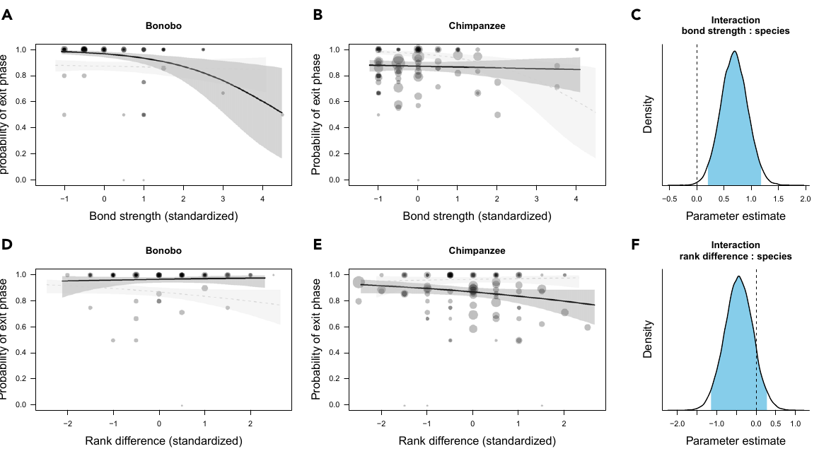
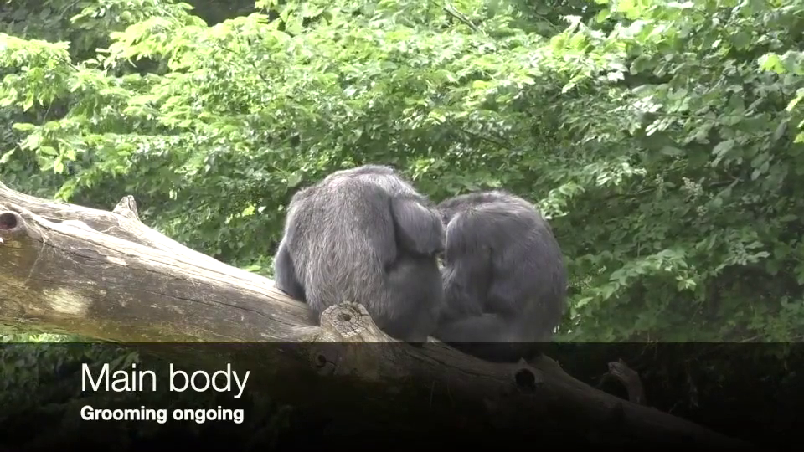
Exit signals coordinate the end of an interaction
An exit phase contains actions surrounding the termination of a joint activity. Heesen and colleagues coded gaze and communicative behaviors before partners disengaged from grooming or play. Ending an interaction was analyzed separately from beginning it.
Video S9 records a 22.1 s chimpanzee exit phase that includes leaving, re-approaching, mutual gaze and hand contact. An exit exchange can allow a partner to respond before physical separation. The recording's movement sequence distinguishes an observable exchange from a conclusion based only on the animals' final locations.
Entry and exit organization connect animal communication to the management of participation, a component of human interaction. The comparison concerns the structure of social coordination rather than the presence of spoken language. Species and relationship differences remain relevant because interaction management need not follow a single uniform ape pattern.
Heesen et al. (2021), Fig. 2. Exit-phase occurrence across relationships
Click video to play in Slide Show. Heesen et al. (2021), Video S9. Chimpanzees coordinate a 22.1 s grooming exit with re-approach, gaze and hand contact..
Heesen et al. (2021)
13
Notes:
• An **exit phase** contains actions surrounding the termination of a joint activity. Heesen and colleagues coded gaze and communicative behaviors before partners disengaged from grooming or play. Ending an interaction was analyzed separately from beginning it.
• Video S9 records a **22.1 s** chimpanzee exit phase that includes leaving, re-approaching, mutual gaze and hand contact. An exit exchange can allow a partner to respond before physical separation. The recording's movement sequence distinguishes an observable exchange from a conclusion based only on the animals' final locations.
• Entry and exit organization connect animal communication to the management of participation, a component of human interaction. The comparison concerns the structure of social coordination rather than the presence of spoken language. Species and relationship differences remain relevant because interaction management need not follow a single uniform ape pattern.
References:
Heesen R, Bangerter A, Zuberbühler K, Iglesias K, Neumann C, Pajot A, Perrenoud L, Guéry JP, Rossano F, Genty E (2021). Assessing joint commitment as a process in great apes. iScience 24:102872. https://doi.org/10.1016/j.isci.2021.102872
Figure: Heesen et al. (2021), Fig. 2. Exit-phase occurrence across relationships
Figure source: https://doi.org/10.1016/j.isci.2021.102872
Article-provided recording: Heesen et al. (2021), Video S9. Chimpanzees coordinate a 22.1 s grooming exit with re-approach, gaze and hand contact..
• Chimpanzees coordinate a 22.1 s grooming exit with re-approach, gaze and hand contact. Original audio track is effectively silent.
Article DOI: https://doi.org/10.1016/j.isci.2021.102872
Original media URL: https://pmc-oa-opendata.s3.amazonaws.com/PMC8390869.1/mmc10.mp4
Credit: Raphaela Heesen and Emilie Genty; Heesen R, Bangerter A, Zuberbühler K, Iglesias K, Neumann C, Pajot A, Perrenoud L, Guéry JP, Rossano F, Genty E (2021). Assessing joint commitment as a process in great apes. iScience 24:102872. https://doi.org/10.1016/j.isci.2021.102872
License: © 2021 The Authors This is an open access article under the CC BY license (http://creativecommons.org/licenses/by/4.0/).
Compatibility: Original publisher MP4 retained byte for byte: H.264/yuv420p video and AAC audio; no conversion or scientific editing.
Playback: click the recording in PowerPoint Slide Show. The credited original article figure remains a static fallback. Full media decode and embedded relationships were checked; interactive PowerPoint playback was unavailable in this environment.

Slide 14
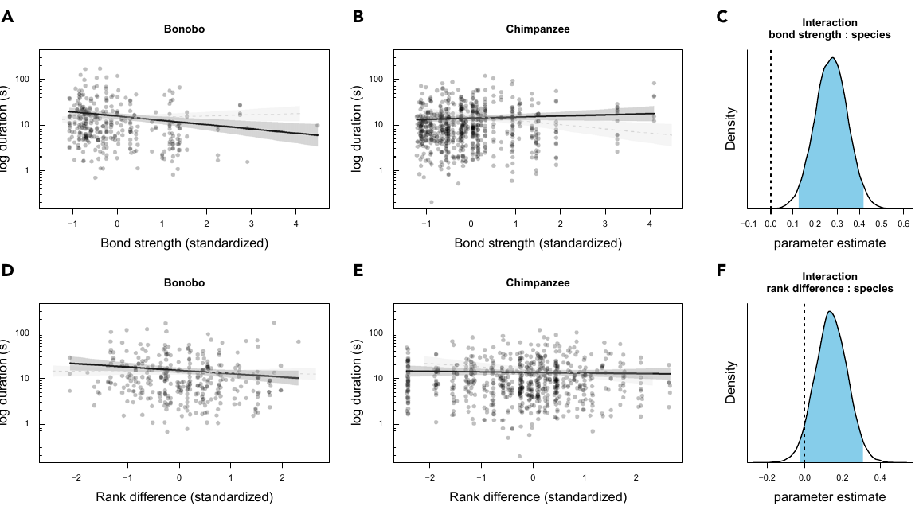
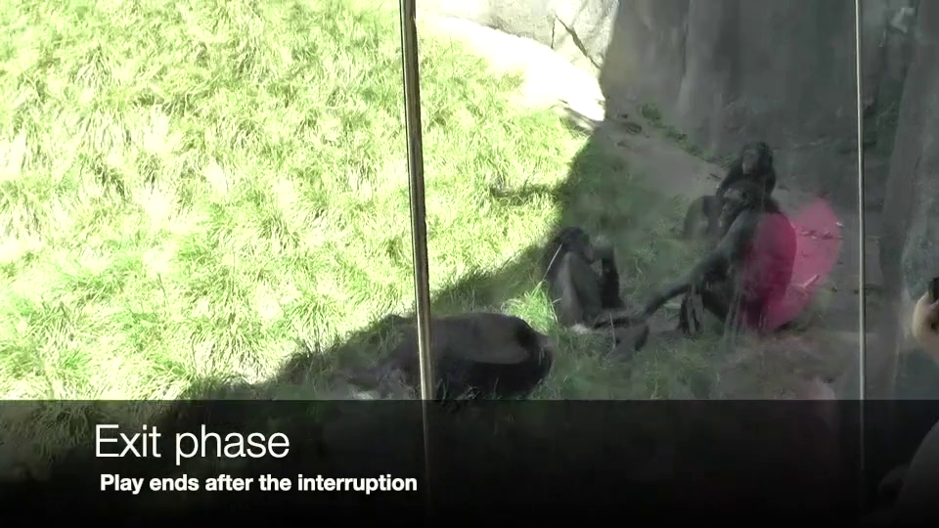
Social relationships alter interaction management
A social bond is a relatively persistent pattern of affiliative association between individuals. The ape study related entry and exit phases to relationship strength and dominance, rather than assuming that every pair managed participation in the same way.
Bonobo exchanges were especially sensitive to relationship variables. Closely bonded partners tended to require less extensive communicative negotiation. Chimpanzee patterns differed, so the comparison did not support treating all great-ape interaction management as one identical behavioral system.
Video S10 records a 9.88 s bonobo exit phase after play, including gaze, a body presentation and hand contact. Observational associations between relationship variables and signaling support a social-regulation account. They do not identify the neural mechanism or establish that relationship strength directly caused the recorded difference in communication.
Heesen et al. (2021), Fig. 4. Exit-phase duration across relationships
Click video to play in Slide Show. Heesen et al. (2021), Video S10. Bonobos coordinate exit from interrupted play using gaze, body presentation and hand contact..
Heesen et al. (2021)
14
Notes:
• A **social bond** is a relatively persistent pattern of affiliative association between individuals. The ape study related entry and exit phases to relationship strength and dominance, rather than assuming that every pair managed participation in the same way.
• Bonobo exchanges were especially sensitive to relationship variables. Closely bonded partners tended to require less extensive communicative negotiation. Chimpanzee patterns differed, so the comparison did not support treating all great-ape interaction management as one identical behavioral system.
• Video S10 records a **9.88 s** bonobo exit phase after play, including gaze, a body presentation and hand contact. Observational associations between relationship variables and signaling support a social-regulation account. They do not identify the neural mechanism or establish that relationship strength directly caused the recorded difference in communication.
References:
Heesen R, Bangerter A, Zuberbühler K, Iglesias K, Neumann C, Pajot A, Perrenoud L, Guéry JP, Rossano F, Genty E (2021). Assessing joint commitment as a process in great apes. iScience 24:102872. https://doi.org/10.1016/j.isci.2021.102872
Figure: Heesen et al. (2021), Fig. 4. Exit-phase duration across relationships
Figure source: https://doi.org/10.1016/j.isci.2021.102872
Article-provided recording: Heesen et al. (2021), Video S10. Bonobos coordinate exit from interrupted play using gaze, body presentation and hand contact..
• Bonobos coordinate exit from interrupted play using gaze, body presentation and hand contact. Original audio track is effectively silent.
Article DOI: https://doi.org/10.1016/j.isci.2021.102872
Original media URL: https://pmc-oa-opendata.s3.amazonaws.com/PMC8390869.1/mmc11.mp4
Credit: Raphaela Heesen and Emilie Genty; Heesen R, Bangerter A, Zuberbühler K, Iglesias K, Neumann C, Pajot A, Perrenoud L, Guéry JP, Rossano F, Genty E (2021). Assessing joint commitment as a process in great apes. iScience 24:102872. https://doi.org/10.1016/j.isci.2021.102872
License: © 2021 The Authors This is an open access article under the CC BY license (http://creativecommons.org/licenses/by/4.0/).
Compatibility: Original publisher MP4 retained byte for byte: H.264/yuv420p video and AAC audio; no conversion or scientific editing.
Playback: click the recording in PowerPoint Slide Show. The credited original article figure remains a static fallback. Full media decode and embedded relationships were checked; interactive PowerPoint playback was unavailable in this environment.

Slide 15
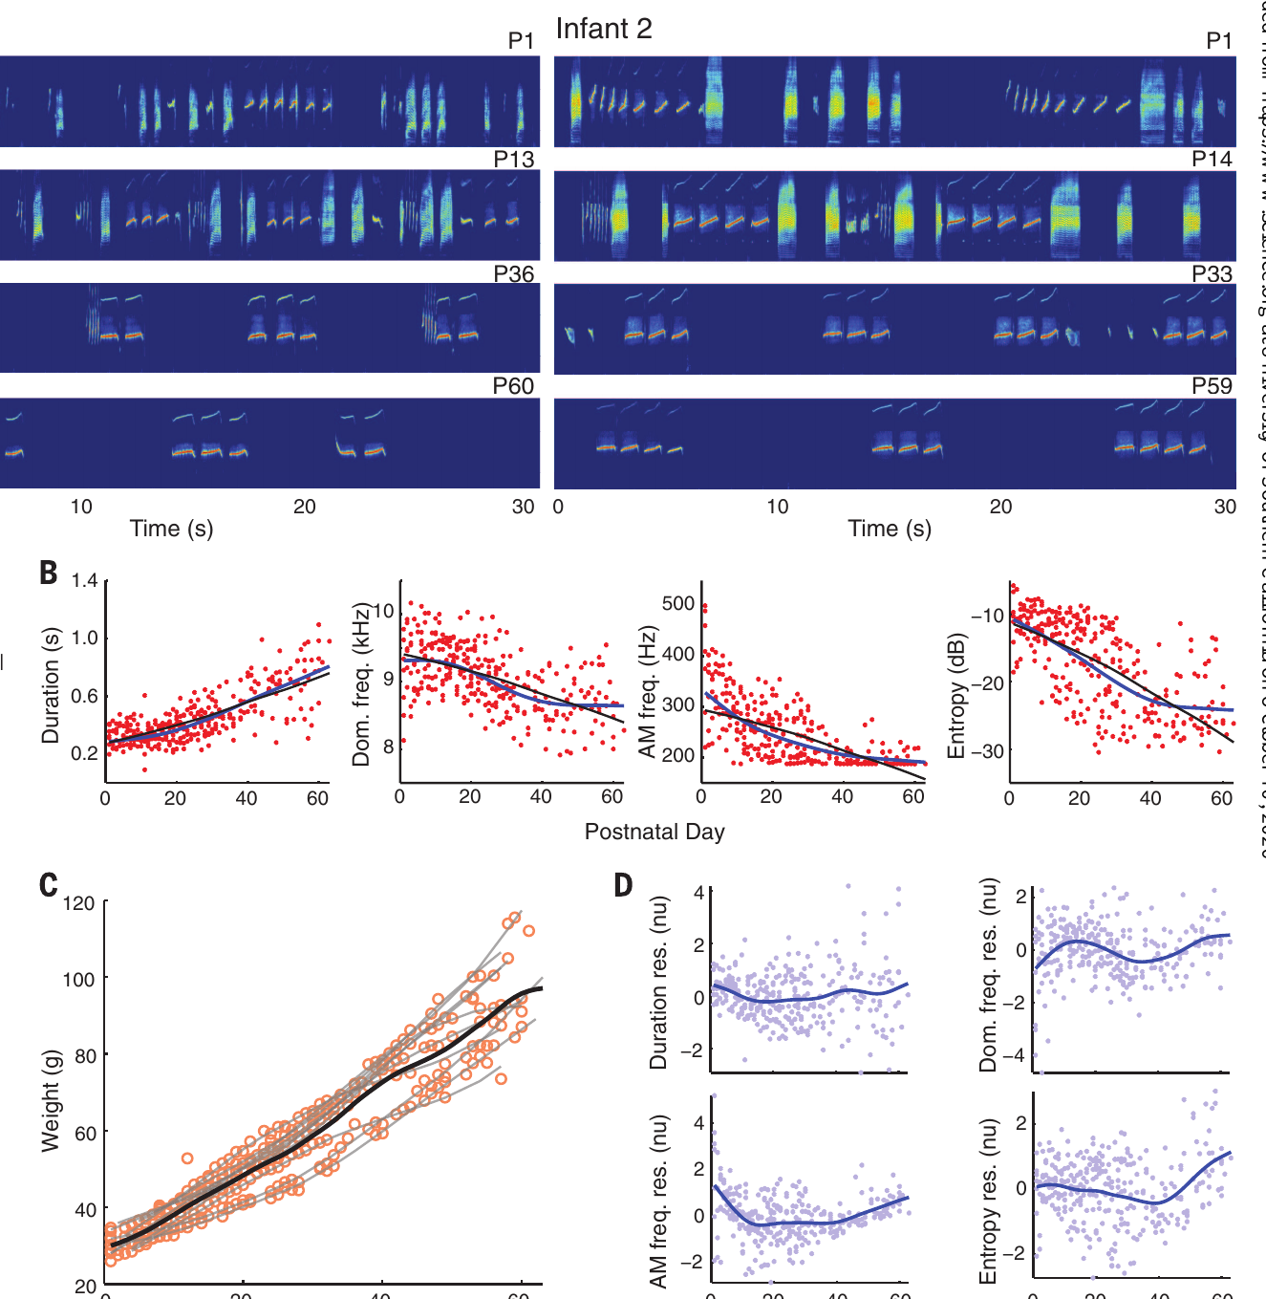
Infant calls develop toward adult contact calls
Vocal development includes changes in the acoustic structure and use of calls after birth. Takahashi and colleagues recorded infant marmosets repeatedly during the first two months of life. Early recordings contained several noisy and tonal call forms rather than only the adult contact-call pattern.
Cry-like calls became less prominent as sustained phee-like calls increased. Call duration and spectral structure changed together. Entropy, a measure of spectral noisiness used in the study, declined as calls became more tonal and adult-like.
Body growth changes the vocal apparatus, but changes in the acoustic trajectories were not explained by growth alone. The published recordings and developmental measurements connect the emergence of the adult pattern to changes in both production physiology and the infant's social interactions with caregivers.
Takahashi et al. (2015), Fig. 1. Developmental spectrograms and changing acoustic features
Takahashi et al. (2015)
15
Notes:
• **Vocal development** includes changes in the acoustic structure and use of calls after birth. Takahashi and colleagues recorded infant marmosets repeatedly during the first two months of life. Early recordings contained several noisy and tonal call forms rather than only the adult contact-call pattern.
• Cry-like calls became less prominent as sustained phee-like calls increased. Call duration and spectral structure changed together. **Entropy**, a measure of spectral noisiness used in the study, declined as calls became more tonal and adult-like.
• Body growth changes the vocal apparatus, but changes in the acoustic trajectories were not explained by growth alone. The published recordings and developmental measurements connect the emergence of the adult pattern to changes in both production physiology and the infant's social interactions with caregivers.
References:
Takahashi DY, Fenley AR, Teramoto Y, Narayanan DZ, Borjon JI, Holmes P, Ghazanfar AA (2015). LANGUAGE DEVELOPMENT. The developmental dynamics of marmoset monkey vocal production. Science (New York, N.Y.) 349:734-738. https://doi.org/10.1126/science.aab1058
Figure: Takahashi et al. (2015), Fig. 1. Developmental spectrograms and changing acoustic features
Figure source: https://doi.org/10.1126/science.aab1058

Slide 16
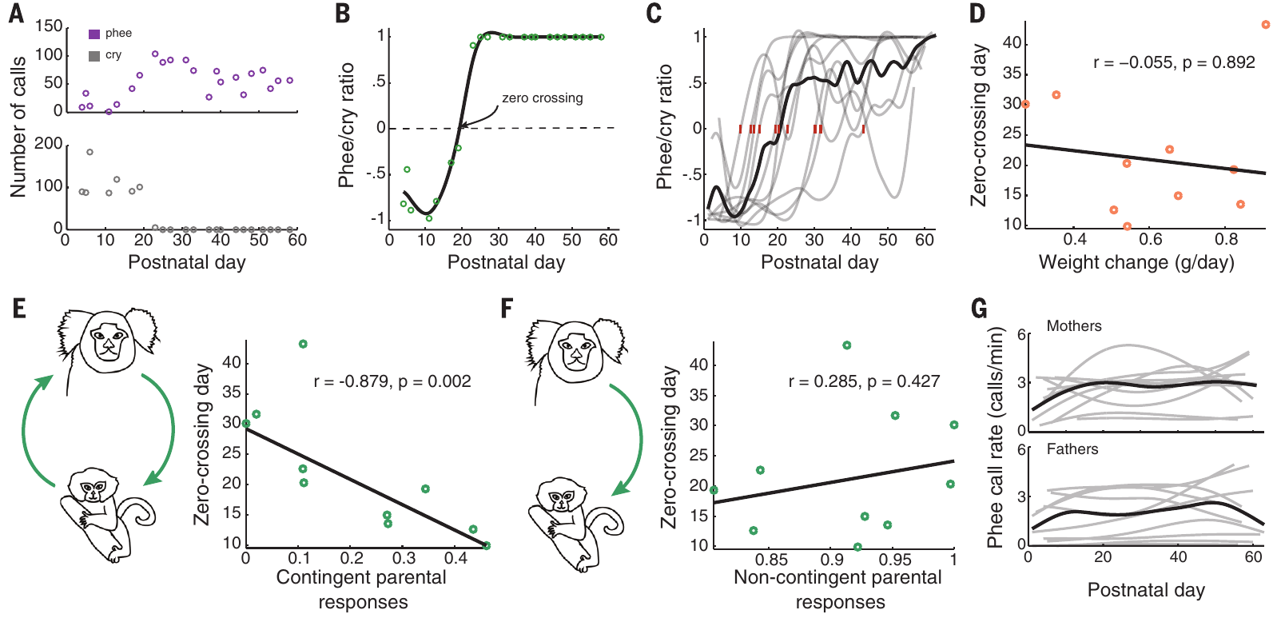
Contingent parental responses accelerate development
Contingent feedback is a response linked in time to the infant's own behavior. The marmoset study compared vocal development with the proportion of infant calls followed by a parental response. Noncontingent calls provided a comparison with parental sound that was not linked to the infant's preceding call.
Infants receiving more contingent responses shifted toward mature-sounding contact calls sooner. The association concerned the transition from noisy cry-like forms to tonal phee calls, not acquisition of an entirely new human-like repertoire.
A parental call can alter the infant's arousal and its opportunities to produce a more stable vocalization. The proposed developmental mechanism combines social feedback with the changing physical apparatus. The specific neural pathway mediating this feedback was not established by the acoustic-development experiment.
Takahashi et al. (2015), Fig. 4. Vocal maturation in relation to contingent parental responses
Takahashi et al. (2015)
16
Notes:
• **Contingent feedback** is a response linked in time to the infant's own behavior. The marmoset study compared vocal development with the proportion of infant calls followed by a parental response. Noncontingent calls provided a comparison with parental sound that was not linked to the infant's preceding call.
• Infants receiving more contingent responses shifted toward mature-sounding contact calls sooner. The association concerned the transition from noisy cry-like forms to tonal phee calls, not acquisition of an entirely new human-like repertoire.
• A parental call can alter the infant's arousal and its opportunities to produce a more stable vocalization. The proposed developmental mechanism combines social feedback with the changing physical apparatus. The specific neural pathway mediating this feedback was not established by the acoustic-development experiment.
References:
Takahashi DY, Fenley AR, Teramoto Y, Narayanan DZ, Borjon JI, Holmes P, Ghazanfar AA (2015). LANGUAGE DEVELOPMENT. The developmental dynamics of marmoset monkey vocal production. Science (New York, N.Y.) 349:734-738. https://doi.org/10.1126/science.aab1058
Figure: Takahashi et al. (2015), Fig. 4. Vocal maturation in relation to contingent parental responses
Figure source: https://doi.org/10.1126/science.aab1058

Slide 17
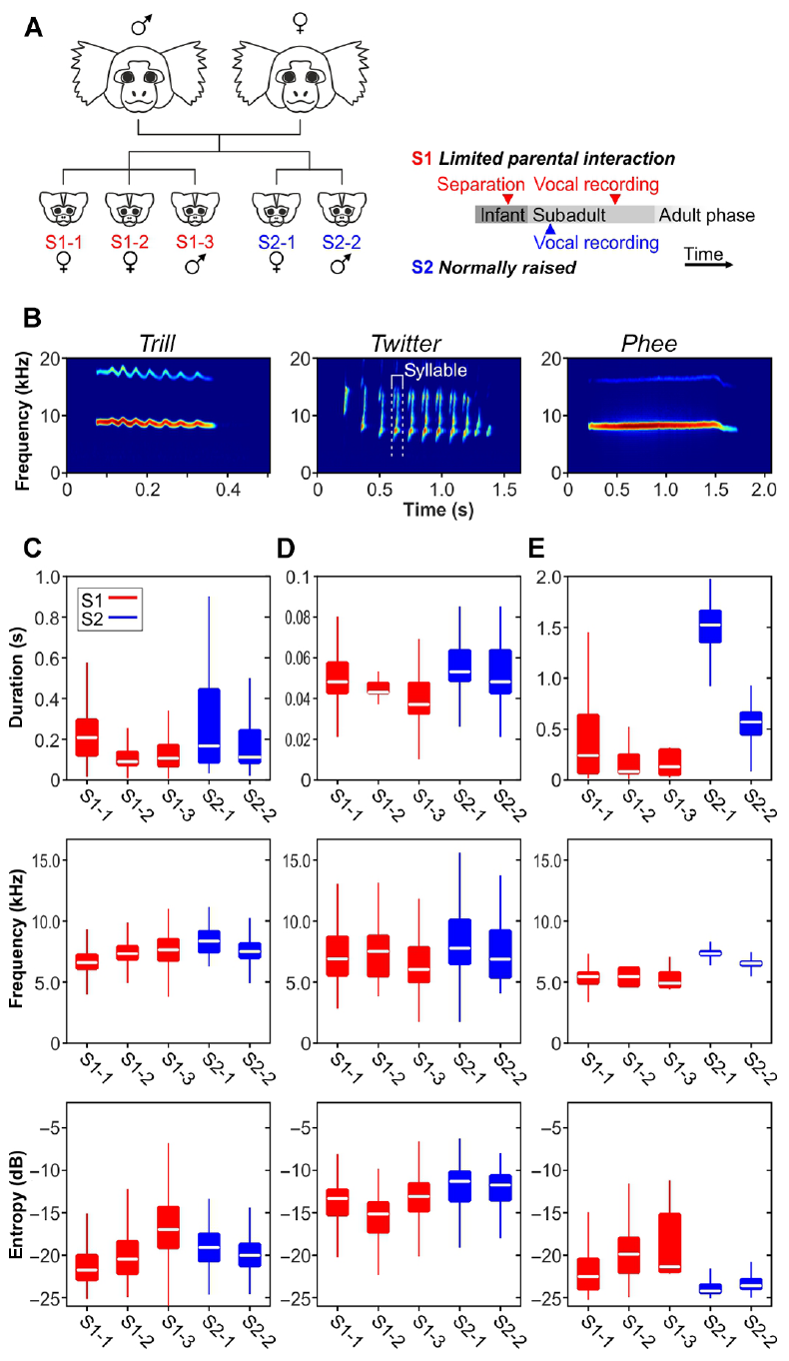
Restricted parental interaction preserves immature calls
Social experience can change vocal development even when the species-typical repertoire remains recognizable. Gultekin and Hage compared marmosets with restricted parental interaction against normally raised animals. Their recordings sampled multiple call types and developmental stages.
Animals with restricted experience retained acoustic features and call sequences typical of younger stages. The differences included the persistence of infant-like forms and atypical combinations, rather than a simple absence of all vocal behavior.
A normally raised comparison distinguishes delayed or altered maturation from features that every marmoset produces throughout life. The rearing manipulation affected a broad social environment, so its behavioral effects cannot be assigned exclusively to one feedback signal. The finding nevertheless establishes that normal acoustic maturation is sensitive to interaction history.
Gultekin & Hage (2018), Fig. 1. Rearing conditions and developmental acoustic measurements
Gultekin & Hage (2018)
17
Notes:
• **Social experience** can change vocal development even when the species-typical repertoire remains recognizable. Gultekin and Hage compared marmosets with restricted parental interaction against normally raised animals. Their recordings sampled multiple call types and developmental stages.
• Animals with restricted experience retained acoustic features and call sequences typical of younger stages. The differences included the persistence of infant-like forms and atypical combinations, rather than a simple absence of all vocal behavior.
• A normally raised comparison distinguishes delayed or altered maturation from features that every marmoset produces throughout life. The rearing manipulation affected a broad social environment, so its behavioral effects cannot be assigned exclusively to one feedback signal. The finding nevertheless establishes that normal acoustic maturation is sensitive to interaction history.
References:
Gultekin YB, Hage SR (2018). Limiting parental interaction during vocal development affects acoustic call structure in marmoset monkeys. Science advances 4:eaar4012. https://doi.org/10.1126/sciadv.aar4012
Figure: Gultekin & Hage (2018), Fig. 1. Rearing conditions and developmental acoustic measurements
Figure source: https://doi.org/10.1126/sciadv.aar4012

Slide 18
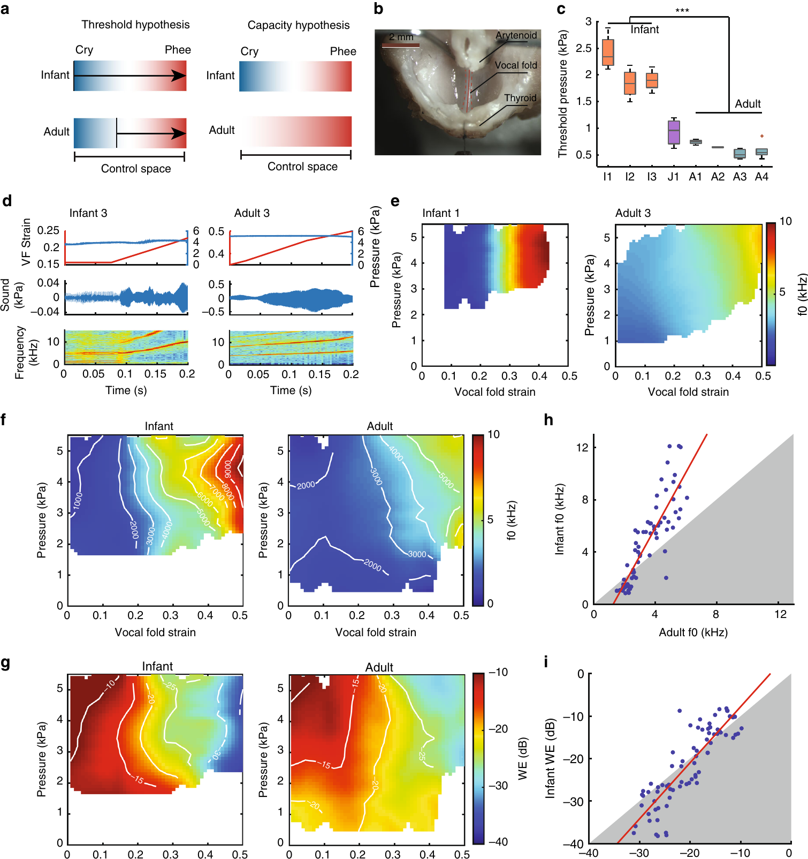
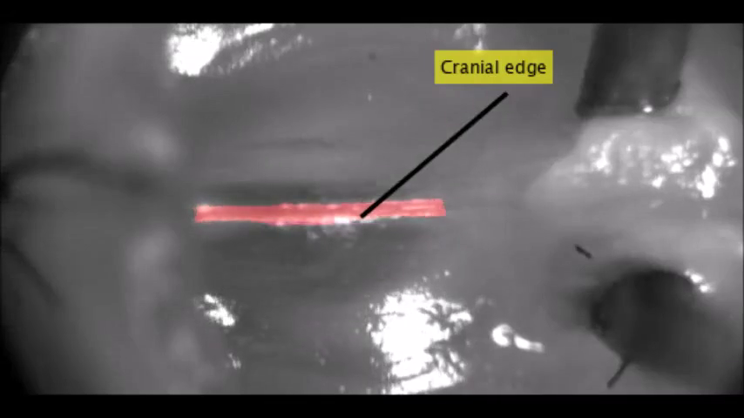
The infant larynx supports several acoustic regimes
The larynx is the organ containing the vocal folds, whose motion can modulate airflow into sound. Zhang and colleagues compared excised infant and adult marmoset larynges while controlling airflow pressure and tissue strain. This preparation separates the apparatus's physical capacity from an intact animal's neural choices.
Strain is the relative deformation of tissue under stretch. Infant larynges supported a broader range of acoustic regimes across pressure and strain than adult larynges. Their physical properties could produce both noisy cry-like outputs and more tonal sounds.
Supplementary Movie 1 records an infant larynx at low strain. Its slow motion and colored edge labels were supplied by the authors. The preparation tests tissue dynamics directly; it does not record a freely behaving infant deciding to cry.
Zhang et al. (2019), Fig. 2. Infant and adult laryngeal preparations and acoustic regimes
Click video to play in Slide Show. Zhang et al. (2019), Supplementary Movie 1. An infant marmoset larynx oscillates at low strain.
Zhang et al. (2019)
18
Notes:
• The **larynx** is the organ containing the vocal folds, whose motion can modulate airflow into sound. Zhang and colleagues compared excised infant and adult marmoset larynges while controlling airflow pressure and tissue strain. This preparation separates the apparatus's physical capacity from an intact animal's neural choices.
• **Strain** is the relative deformation of tissue under stretch. Infant larynges supported a broader range of acoustic regimes across pressure and strain than adult larynges. Their physical properties could produce both noisy cry-like outputs and more tonal sounds.
• Supplementary Movie 1 records an infant larynx at low strain. Its slow motion and colored edge labels were supplied by the authors. The preparation tests tissue dynamics directly; it does not record a freely behaving infant deciding to cry.
References:
Zhang YS, Takahashi DY, Liao DA, Ghazanfar AA, Elemans CPH (2019). Vocal state change through laryngeal development. Nature communications 10:4592. https://doi.org/10.1038/s41467-019-12588-6
Figure: Zhang et al. (2019), Fig. 2. Infant and adult laryngeal preparations and acoustic regimes
Figure source: https://doi.org/10.1038/s41467-019-12588-6
Article-provided recording: Zhang et al. (2019), Supplementary Movie 1. An infant marmoset larynx oscillates at low strain.
• An infant marmoset larynx oscillates at low strain. The authors supplied 2000-fold slow motion from 30 kHz acquisition and their original edge labels. Original source has no audio track.
Article DOI: https://doi.org/10.1038/s41467-019-12588-6
Original media URL: https://pmc-oa-opendata.s3.amazonaws.com/PMC6785551.1/41467_2019_12588_MOESM5_ESM.mp4
Credit: Zhang YS, Takahashi DY, Liao DA, Ghazanfar AA, Elemans CPH (2019). Vocal state change through laryngeal development. Nature communications 10:4592. https://doi.org/10.1038/s41467-019-12588-6
License: Open Access This article is licensed under a Creative Commons Attribution 4.0 International License, which permits use, sharing, adaptation, distribution and reproduction in any medium or format, as long as you give appropriate credit to the original author(s) and the source, provide a link to the Creative Commons license, and indicate if changes were made. The images or other third party material in this article are included in the article’s Creative Commons license, unless indicated otherwise in a credit line to the material. If material is not included in the article’s Creative Commons license and your intended use is not permitted by statutory regulation or exceeds the permitted use, you will need to obtain permission directly from the copyright holder. To view a copy of this license, visit http://creativecommons.org/licenses/by/4.0/ .
Compatibility: H.264/yuv420p MP4; full scene, dimensions, source timing and original audio preserved. Any slow motion or annotations are supplied by the source authors.
Playback: click the recording in PowerPoint Slide Show. The credited original article figure remains a static fallback. Full media decode and embedded relationships were checked; interactive PowerPoint playback was unavailable in this environment.

Slide 19
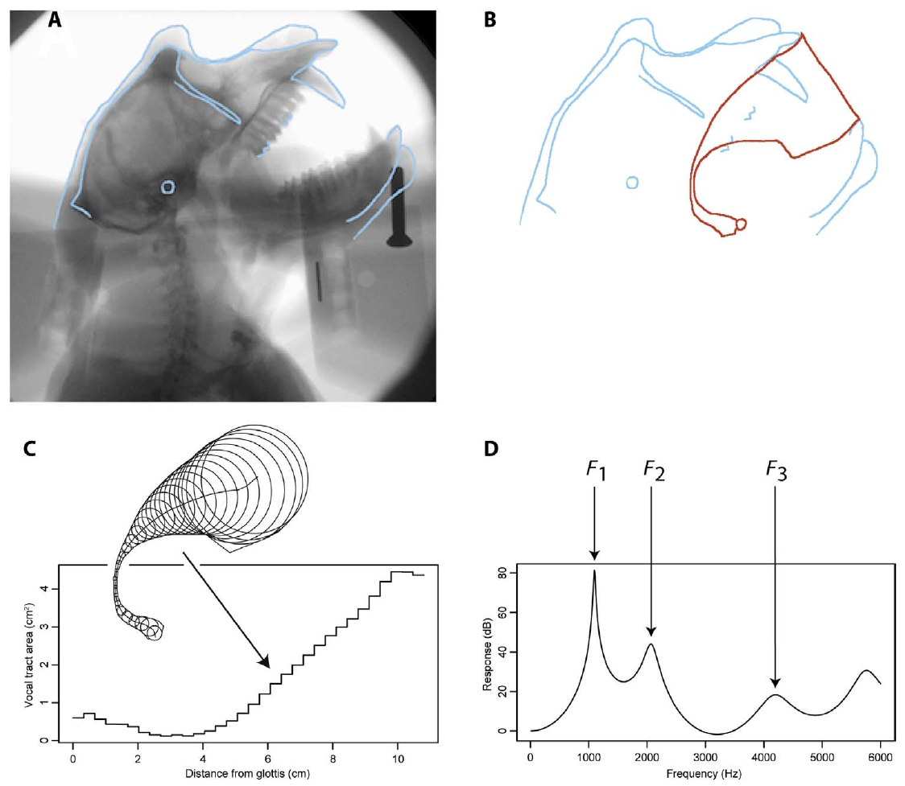
Macaque vocal tracts can support contrasting vowels
The vocal tract is the air-filled pathway above the sound source, including the pharyngeal and oral cavities. Fitch and colleagues recorded X-ray movies of a living macaque during vocalization, feeding and facial movements, then reconstructed observed tract configurations.
A formant is a resonance of the vocal tract. The first two formants help distinguish vowel qualities. Models based on the observed macaque configurations occupied a larger acoustic space than earlier estimates derived from a single postmortem configuration.
The modeled tract could support several perceptually distinguishable vowel-like sounds. These were possible acoustic outputs calculated from observed anatomy, not words spoken by the macaque. The physical capacity of the tract therefore cannot by itself explain the lack of human speech in this species.
Fitch et al. (2016), Fig. 1. X-ray anatomy and vocal-tract reconstruction
Fitch et al. (2016)
19
Notes:
• The **vocal tract** is the air-filled pathway above the sound source, including the pharyngeal and oral cavities. Fitch and colleagues recorded X-ray movies of a living macaque during vocalization, feeding and facial movements, then reconstructed observed tract configurations.
• A **formant** is a resonance of the vocal tract. The first two formants help distinguish vowel qualities. Models based on the observed macaque configurations occupied a larger acoustic space than earlier estimates derived from a single postmortem configuration.
• The modeled tract could support several perceptually distinguishable vowel-like sounds. These were possible acoustic outputs calculated from observed anatomy, not words spoken by the macaque. The physical capacity of the tract therefore cannot by itself explain the lack of human speech in this species.
References:
Fitch WT, de Boer B, Mathur N, Ghazanfar AA (2016). Monkey vocal tracts are speech-ready. Science advances 2:e1600723. https://doi.org/10.1126/sciadv.1600723
Figure: Fitch et al. (2016), Fig. 1. X-ray anatomy and vocal-tract reconstruction
Figure source: https://doi.org/10.1126/sciadv.1600723

Slide 20
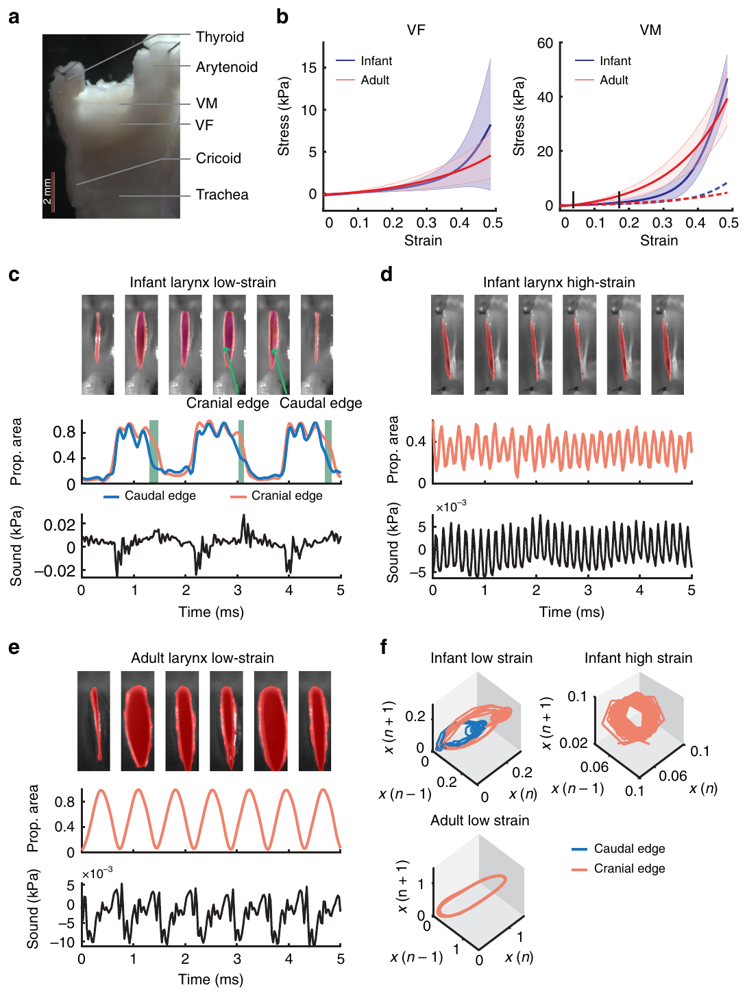
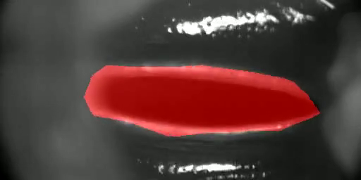
Stretch changes how infant vocal tissue oscillates
Phonation is sound production associated with airflow-driven tissue vibration. In the excised infant marmoset larynx, low and high strain generated different vibration patterns. The researchers measured the movement of cranial and caudal tissue edges with high-speed imaging.
At higher strain, the infant preparation could enter a more tonal regime associated with a phee-like acoustic output. The change occurred while the apparatus was studied outside the nervous system. Mechanical properties therefore contribute directly to the transition between noisy and regular vibration.
Supplementary Movie 2 contains the original high-strain infant recording. Its playback is slower than real-time tissue motion because the authors supplied it as a high-speed-film presentation. The experimental contrast identifies a mechanical contribution without assigning the mature call transition entirely to tissue stretch.
Zhang et al. (2019), Fig. 3. Laryngeal anatomy, edge motion and strain-dependent vibration
Click video to play in Slide Show. Zhang et al. (2019), Supplementary Movie 2. An infant marmoset larynx oscillates at high strain.
Zhang et al. (2019)
20
Notes:
• **Phonation** is sound production associated with airflow-driven tissue vibration. In the excised infant marmoset larynx, low and high strain generated different vibration patterns. The researchers measured the movement of cranial and caudal tissue edges with high-speed imaging.
• At higher strain, the infant preparation could enter a more tonal regime associated with a phee-like acoustic output. The change occurred while the apparatus was studied outside the nervous system. Mechanical properties therefore contribute directly to the transition between noisy and regular vibration.
• Supplementary Movie 2 contains the original high-strain infant recording. Its playback is slower than real-time tissue motion because the authors supplied it as a high-speed-film presentation. The experimental contrast identifies a mechanical contribution without assigning the mature call transition entirely to tissue stretch.
References:
Zhang YS, Takahashi DY, Liao DA, Ghazanfar AA, Elemans CPH (2019). Vocal state change through laryngeal development. Nature communications 10:4592. https://doi.org/10.1038/s41467-019-12588-6
Figure: Zhang et al. (2019), Fig. 3. Laryngeal anatomy, edge motion and strain-dependent vibration
Figure source: https://doi.org/10.1038/s41467-019-12588-6
Article-provided recording: Zhang et al. (2019), Supplementary Movie 2. An infant marmoset larynx oscillates at high strain.
• An infant marmoset larynx oscillates at high strain. The authors supplied 1000-fold slow motion from 30 kHz acquisition and their original edge labels. Original source has no audio track.
Article DOI: https://doi.org/10.1038/s41467-019-12588-6
Original media URL: https://pmc-oa-opendata.s3.amazonaws.com/PMC6785551.1/41467_2019_12588_MOESM6_ESM.mp4
Credit: Zhang YS, Takahashi DY, Liao DA, Ghazanfar AA, Elemans CPH (2019). Vocal state change through laryngeal development. Nature communications 10:4592. https://doi.org/10.1038/s41467-019-12588-6
License: Open Access This article is licensed under a Creative Commons Attribution 4.0 International License, which permits use, sharing, adaptation, distribution and reproduction in any medium or format, as long as you give appropriate credit to the original author(s) and the source, provide a link to the Creative Commons license, and indicate if changes were made. The images or other third party material in this article are included in the article’s Creative Commons license, unless indicated otherwise in a credit line to the material. If material is not included in the article’s Creative Commons license and your intended use is not permitted by statutory regulation or exceeds the permitted use, you will need to obtain permission directly from the copyright holder. To view a copy of this license, visit http://creativecommons.org/licenses/by/4.0/ .
Compatibility: H.264/yuv420p MP4; full scene, dimensions, source timing and original audio preserved. Any slow motion or annotations are supplied by the source authors.
Playback: click the recording in PowerPoint Slide Show. The credited original article figure remains a static fallback. Full media decode and embedded relationships were checked; interactive PowerPoint playback was unavailable in this environment.

Slide 21
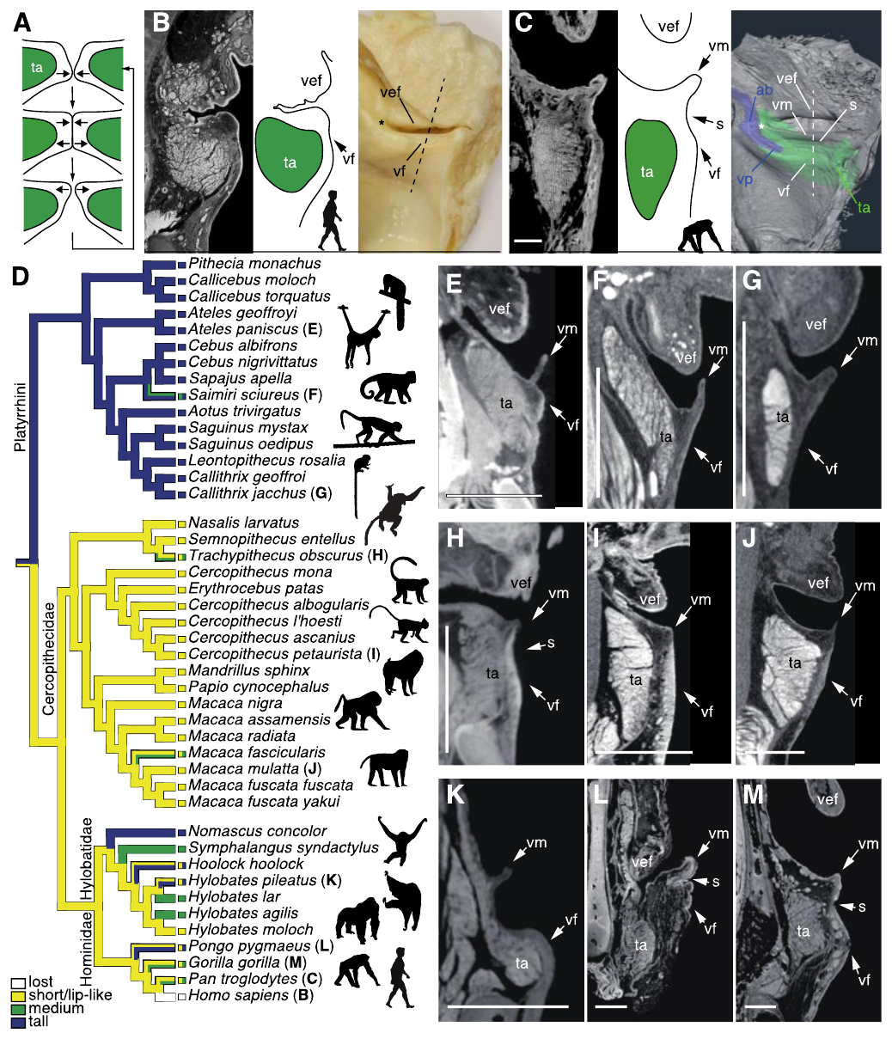
Human larynges lack the surveyed vocal membranes
A vocal membrane is a thin extension of the vocal fold found in many nonhuman primates. Nishimura and colleagues compared laryngeal anatomy across a broad sample of primate species using anatomical specimens and imaging. Human specimens lacked the membrane present in the surveyed nonhuman primates.
The study also compared other features, including laryngeal air sacs. These anatomical differences change the structures that can participate in vibration. The comparison establishes a physical distinction between the human sound source and those of closely related animals.
Loss of a vibrating extension may favor more stable phonation, but an anatomical change is not a fossil date for language. The study's evolutionary interpretation combines comparative anatomy with vibration experiments. It does not infer that every animal with a membrane is incapable of useful vocal control.
Nishimura et al. (2022), Fig. 1. Comparative primate vocal-fold and membrane anatomy
Nishimura et al. (2022)
21
Notes:
• A **vocal membrane** is a thin extension of the vocal fold found in many nonhuman primates. Nishimura and colleagues compared laryngeal anatomy across a broad sample of primate species using anatomical specimens and imaging. Human specimens lacked the membrane present in the surveyed nonhuman primates.
• The study also compared other features, including laryngeal air sacs. These anatomical differences change the structures that can participate in vibration. The comparison establishes a physical distinction between the human sound source and those of closely related animals.
• Loss of a vibrating extension may favor more stable phonation, but an anatomical change is not a fossil date for language. The study's evolutionary interpretation combines comparative anatomy with vibration experiments. It does not infer that every animal with a membrane is incapable of useful vocal control.
References:
Nishimura T, Tokuda IT, Miyachi S, Dunn JC, Herbst CT, Ishimura K, Kaneko A, Kinoshita Y, Koda H, Saers JPP, Imai H, Matsuda T, Larsen ON, Jürgens U, Hirabayashi H, Kojima S, Fitch WT (2022). Evolutionary loss of complexity in human vocal anatomy as an adaptation for speech. Science (New York, N.Y.) 377:760-763. https://doi.org/10.1126/science.abm1574
Figure: Nishimura et al. (2022), Fig. 1. Comparative primate vocal-fold and membrane anatomy
Figure source: https://doi.org/10.1126/science.abm1574

Slide 22
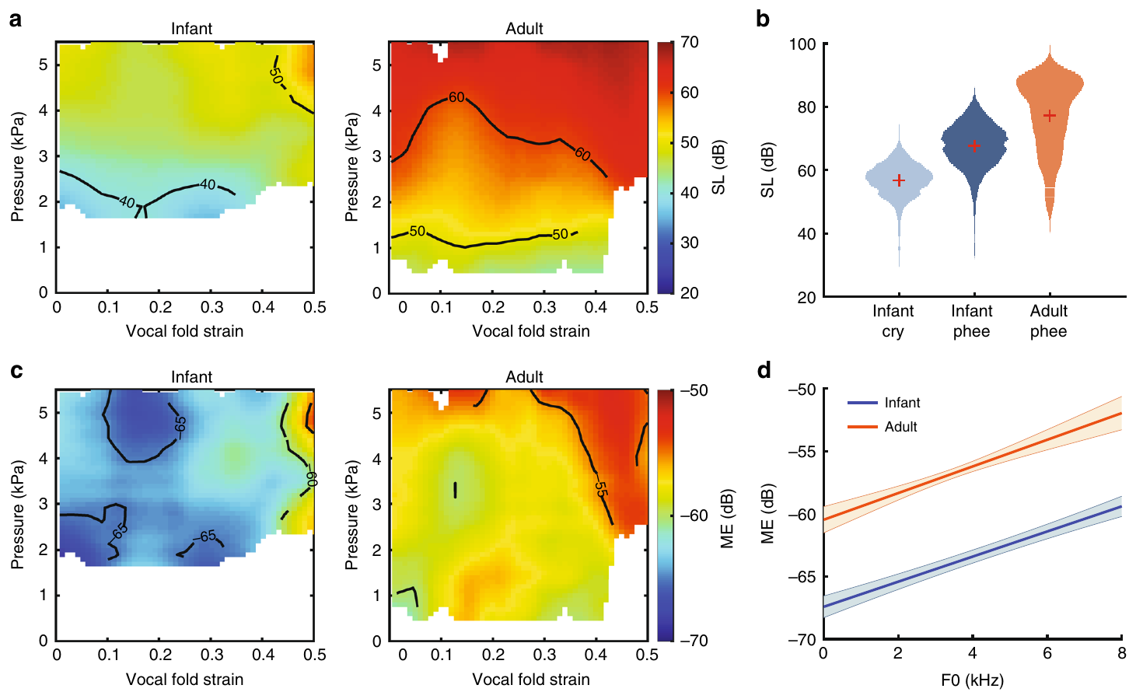

Adult tissue produces tonal sound more efficiently
Aerodynamic efficiency concerns how much useful acoustic output is obtained from airflow and pressure. Zhang and colleagues compared pressure requirements and acoustic output in infant and adult marmoset larynges over controlled strain conditions.
Adult preparations could sustain phee-like sound at lower energetic demands than infant preparations. Development therefore changed both the available acoustic regimes and the ease of maintaining a mature tonal output. The original pressure and acoustic maps retain their measured units.
Supplementary Movie 3 records an adult larynx at low strain. Comparison with the infant recordings connects a visible change in tissue motion to the measured acoustic regime. Efficient adult tissue supports mature calling, while the intact animal still requires neural coordination of respiratory pressure and laryngeal configuration.
Zhang et al. (2019), Fig. 4. Pressure, acoustic output and efficiency across development
Click video to play in Slide Show. Zhang et al. (2019), Supplementary Movie 3. An adult marmoset larynx oscillates at low strain.
Zhang et al. (2019)
22
Notes:
• **Aerodynamic efficiency** concerns how much useful acoustic output is obtained from airflow and pressure. Zhang and colleagues compared pressure requirements and acoustic output in infant and adult marmoset larynges over controlled strain conditions.
• Adult preparations could sustain phee-like sound at lower energetic demands than infant preparations. Development therefore changed both the available acoustic regimes and the ease of maintaining a mature tonal output. The original pressure and acoustic maps retain their measured units.
• Supplementary Movie 3 records an adult larynx at low strain. Comparison with the infant recordings connects a visible change in tissue motion to the measured acoustic regime. Efficient adult tissue supports mature calling, while the intact animal still requires neural coordination of respiratory pressure and laryngeal configuration.
References:
Zhang YS, Takahashi DY, Liao DA, Ghazanfar AA, Elemans CPH (2019). Vocal state change through laryngeal development. Nature communications 10:4592. https://doi.org/10.1038/s41467-019-12588-6
Figure: Zhang et al. (2019), Fig. 4. Pressure, acoustic output and efficiency across development
Figure source: https://doi.org/10.1038/s41467-019-12588-6
Article-provided recording: Zhang et al. (2019), Supplementary Movie 3. An adult marmoset larynx oscillates at low strain.
• An adult marmoset larynx oscillates at low strain. The authors supplied 1000-fold slow motion from 30 kHz acquisition and their original edge labels. Original source has no audio track.
Article DOI: https://doi.org/10.1038/s41467-019-12588-6
Original media URL: https://pmc-oa-opendata.s3.amazonaws.com/PMC6785551.1/41467_2019_12588_MOESM7_ESM.mp4
Credit: Zhang YS, Takahashi DY, Liao DA, Ghazanfar AA, Elemans CPH (2019). Vocal state change through laryngeal development. Nature communications 10:4592. https://doi.org/10.1038/s41467-019-12588-6
License: Open Access This article is licensed under a Creative Commons Attribution 4.0 International License, which permits use, sharing, adaptation, distribution and reproduction in any medium or format, as long as you give appropriate credit to the original author(s) and the source, provide a link to the Creative Commons license, and indicate if changes were made. The images or other third party material in this article are included in the article’s Creative Commons license, unless indicated otherwise in a credit line to the material. If material is not included in the article’s Creative Commons license and your intended use is not permitted by statutory regulation or exceeds the permitted use, you will need to obtain permission directly from the copyright holder. To view a copy of this license, visit http://creativecommons.org/licenses/by/4.0/ .
Compatibility: H.264/yuv420p MP4; full scene, dimensions, source timing and original audio preserved. Any slow motion or annotations are supplied by the source authors.
Playback: click the recording in PowerPoint Slide Show. The credited original article figure remains a static fallback. Full media decode and embedded relationships were checked; interactive PowerPoint playback was unavailable in this environment.

Slide 23
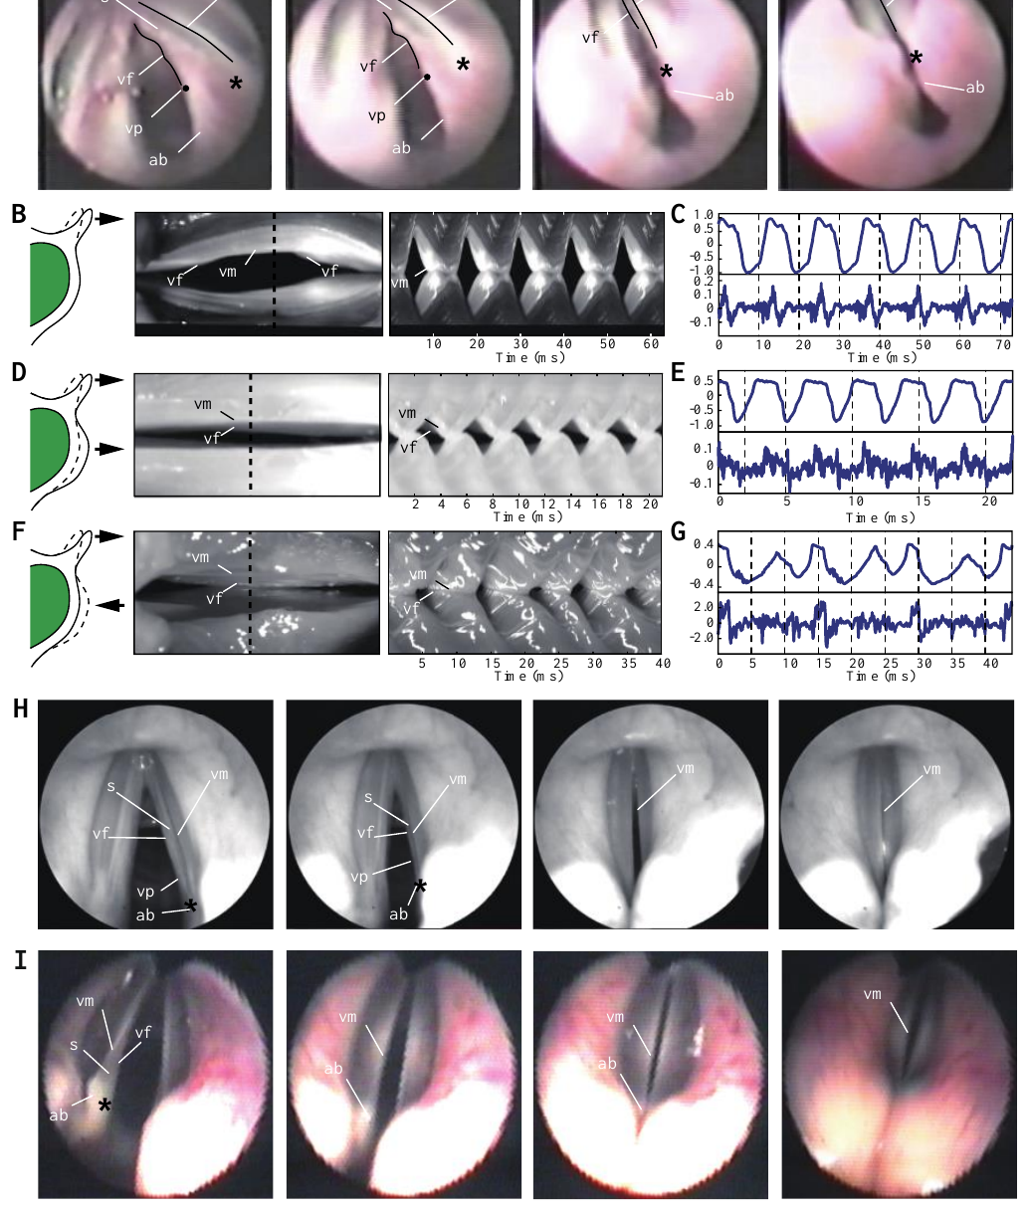
Membrane vibration can destabilize the sound source
Periodic vibration repeats regularly and supports a harmonic sound spectrum. High-speed recordings in Nishimura and colleagues' study revealed several ways that nonhuman primate vocal membranes and folds could vibrate together or separately.
The membrane could participate while the fold itself moved little, or the two structures could move with different timing. Under some conditions, their interaction produced irregular acoustic output. The published images connect the physical movement of the sound source with corresponding recordings of sound and tissue motion.
A simpler human sound source was proposed to reduce transitions into unstable regimes. This proposal concerns the reliability of phonation rather than word meaning or syntax. Stable source vibration and flexible vocal-tract shaping solve different production problems and depend on coordinated control in a speaking animal.
Nishimura et al. (2022), Fig. 2. Original endoscopic images and membrane-motion recordings
Nishimura et al. (2022)
23
Notes:
• **Periodic vibration** repeats regularly and supports a harmonic sound spectrum. High-speed recordings in Nishimura and colleagues' study revealed several ways that nonhuman primate vocal membranes and folds could vibrate together or separately.
• The membrane could participate while the fold itself moved little, or the two structures could move with different timing. Under some conditions, their interaction produced irregular acoustic output. The published images connect the physical movement of the sound source with corresponding recordings of sound and tissue motion.
• A simpler human sound source was proposed to reduce transitions into unstable regimes. This proposal concerns the reliability of phonation rather than word meaning or syntax. Stable source vibration and flexible vocal-tract shaping solve different production problems and depend on coordinated control in a speaking animal.
References:
Nishimura T, Tokuda IT, Miyachi S, Dunn JC, Herbst CT, Ishimura K, Kaneko A, Kinoshita Y, Koda H, Saers JPP, Imai H, Matsuda T, Larsen ON, Jürgens U, Hirabayashi H, Kojima S, Fitch WT (2022). Evolutionary loss of complexity in human vocal anatomy as an adaptation for speech. Science (New York, N.Y.) 377:760-763. https://doi.org/10.1126/science.abm1574
Figure: Nishimura et al. (2022), Fig. 2. Original endoscopic images and membrane-motion recordings
Figure source: https://doi.org/10.1126/science.abm1574

Slide 24
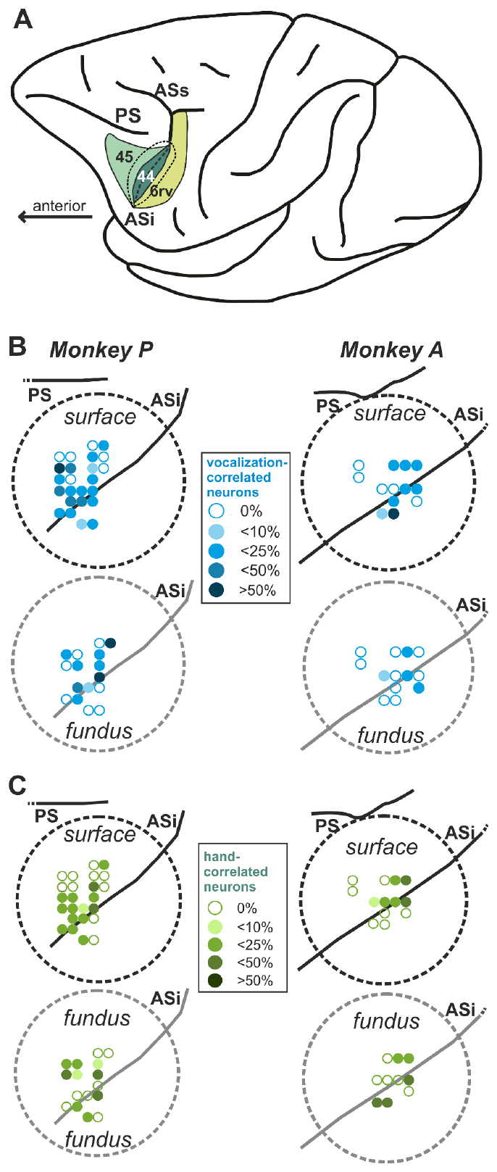
Frontal recordings distinguish vocal and manual control
The ventrolateral prefrontal cortex is a frontal region involved in regulating actions. Gavrilov and Nieder recorded rhesus macaque neurons in frontal areas that include proposed homologues of human Broca's region. A homologue is a structure related by evolutionary ancestry.
The macaques learned cued vocal and manual responses in a go/no-go task. A go cue permitted a response; catch trials required withholding it. The design compared planning and execution of a call with planning and execution of a hand movement.
Histologically informed anatomical localization distinguished posterior ventral premotor cortex, an area near the inferior arcuate sulcus and the ventral prearcuate region. Mapping these sites matters because similar behavioral effects do not establish that the same anatomical population controls both response types.
Gavrilov & Nieder (2021), Fig. 4. Recording locations in rhesus frontal cortex
Gavrilov & Nieder (2021)
24
Notes:
• The **ventrolateral prefrontal cortex** is a frontal region involved in regulating actions. Gavrilov and Nieder recorded rhesus macaque neurons in frontal areas that include proposed homologues of human Broca's region. A homologue is a structure related by evolutionary ancestry.
• The macaques learned cued vocal and manual responses in a go/no-go task. A go cue permitted a response; catch trials required withholding it. The design compared planning and execution of a call with planning and execution of a hand movement.
• Histologically informed anatomical localization distinguished posterior ventral premotor cortex, an area near the inferior arcuate sulcus and the ventral prearcuate region. Mapping these sites matters because similar behavioral effects do not establish that the same anatomical population controls both response types.
References:
Gavrilov N, Nieder A (2021). Distinct neural networks for the volitional control of vocal and manual actions in the monkey homologue of Broca's area. eLife 10:e62797. https://doi.org/10.7554/elife.62797
Figure: Gavrilov & Nieder (2021), Fig. 4. Recording locations in rhesus frontal cortex
Figure source: https://doi.org/10.7554/elife.62797

Slide 25
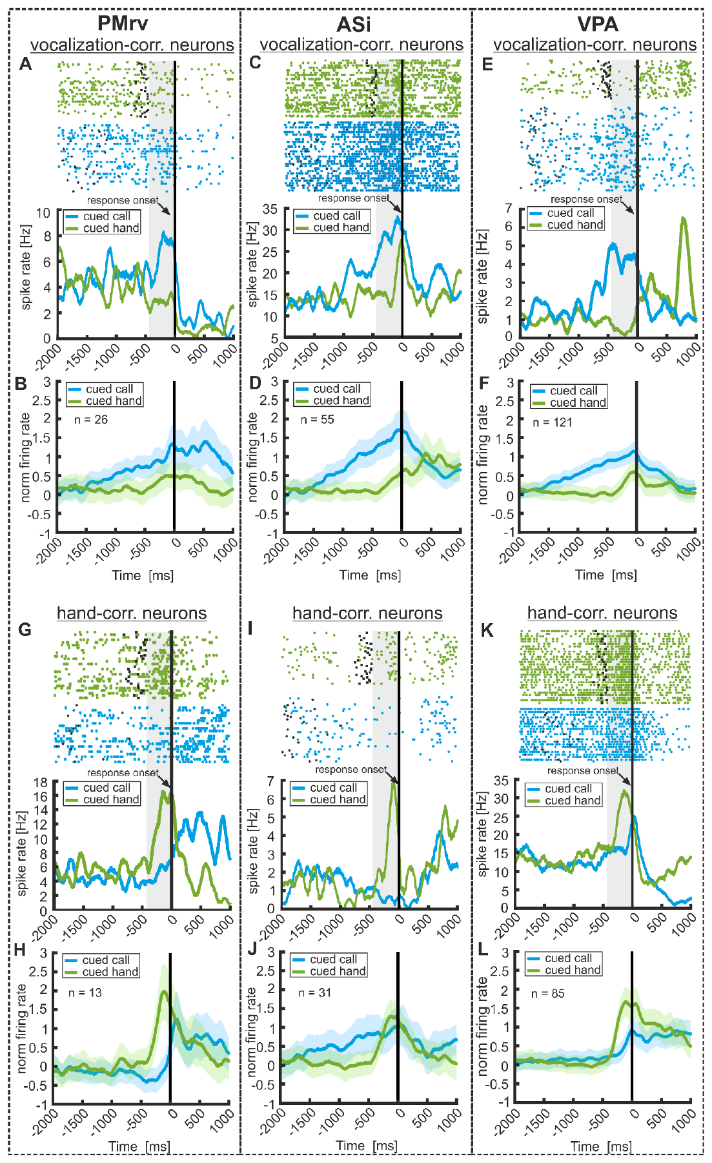
Neuronal preparation differs for calls and hand actions
Preparatory activity is a change in neuronal firing before a movement begins. During the macaque task, some recorded frontal neurons changed their activity before the permitted vocal response or before the permitted hand response.
The study aligned spike timing to cues and behavioral events, allowing response preparation to be distinguished from firing after the sound or movement. Vocal and manual preparation recruited different patterns across the sampled frontal regions.
A region containing neurons associated with both behaviors need not use one identical population for every action. The experiment supports frontal participation in controlled call initiation while separating it from the neural representation of manual action. It concerns trained regulation of existing macaque calls rather than acquisition of articulated speech.
Gavrilov & Nieder (2021), Fig. 5. Spike rasters and activity preceding vocal and manual responses
Gavrilov & Nieder (2021), Fig. 4. Anatomical localization of the sampled frontal regions
Gavrilov & Nieder (2021)
25
Notes:
• **Preparatory activity** is a change in neuronal firing before a movement begins. During the macaque task, some recorded frontal neurons changed their activity before the permitted vocal response or before the permitted hand response.
• The study aligned spike timing to cues and behavioral events, allowing response preparation to be distinguished from firing after the sound or movement. Vocal and manual preparation recruited different patterns across the sampled frontal regions.
• A region containing neurons associated with both behaviors need not use one identical population for every action. The experiment supports frontal participation in controlled call initiation while separating it from the neural representation of manual action. It concerns trained regulation of existing macaque calls rather than acquisition of articulated speech.
References:
Gavrilov N, Nieder A (2021). Distinct neural networks for the volitional control of vocal and manual actions in the monkey homologue of Broca's area. eLife 10:e62797. https://doi.org/10.7554/elife.62797
Figure: Gavrilov & Nieder (2021), Fig. 5. Spike rasters and activity preceding vocal and manual responses
Figure source: https://doi.org/10.7554/elife.62797
Figure: Gavrilov & Nieder (2021), Fig. 4. Anatomical localization of the sampled frontal regions
Figure source: https://doi.org/10.7554/elife.62797

Slide 26
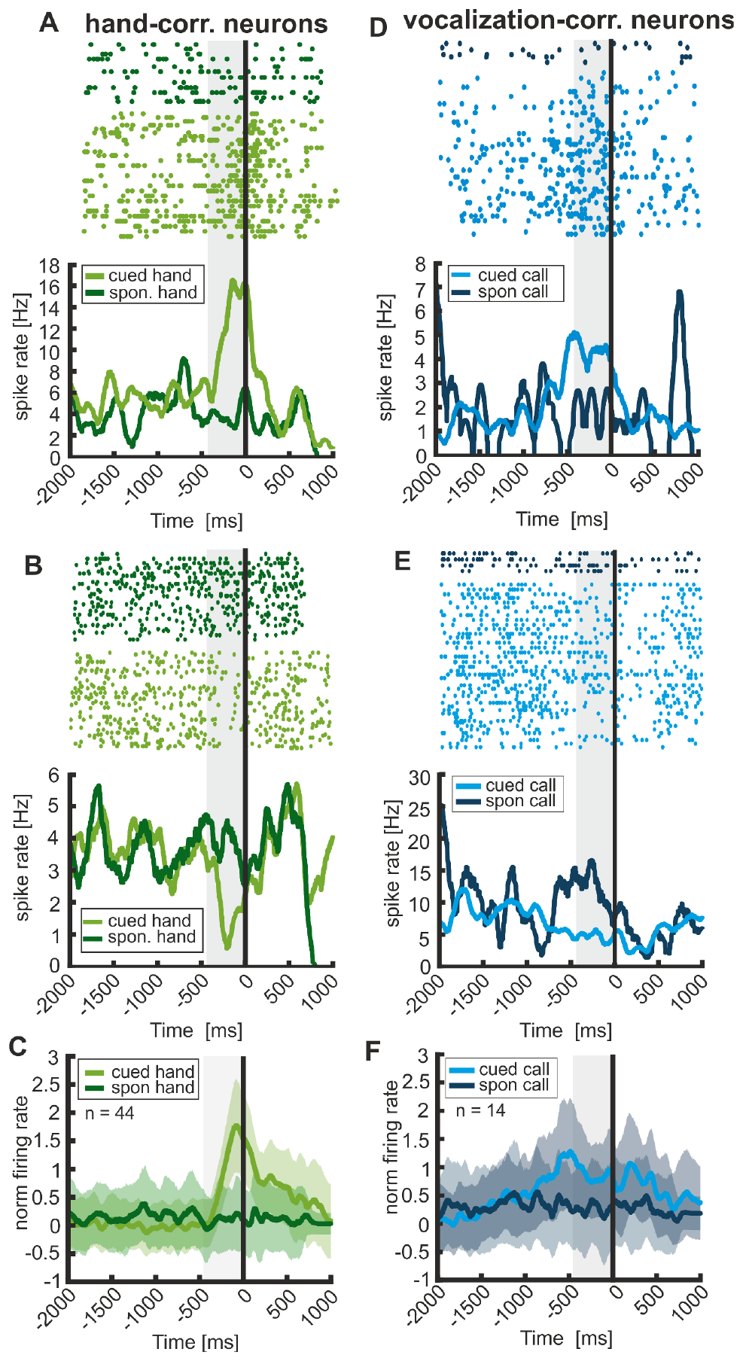
Cued calls differ from spontaneous vocal responses
Volitional control refers here to producing or withholding a response according to a learned task rule. The macaques also produced spontaneous calls and movements outside the instructed response. These events allowed a comparison between similar motor outputs generated in different behavioral circumstances.
Some frontal activity was stronger for task-controlled than spontaneous responses. The comparison separates a signal associated with deciding to act under a cue from one associated only with producing sound or moving the hand.
Cued regulation supplies evidence that nonhuman primate vocal behavior is not exclusively an inflexible reflex. The recorded networks nevertheless differed between vocal and manual actions. Evolutionary accounts that derive speech control from gesture must explain how distinct action networks became integrated, rather than assuming that every hand-related neuron already controls speech.
Gavrilov & Nieder (2021), Fig. 7. Activity around cued and spontaneous responses
Gavrilov & Nieder (2021), Fig. 4. Frontal cortical anatomy
Gavrilov & Nieder (2021)
26
Notes:
• **Volitional control** refers here to producing or withholding a response according to a learned task rule. The macaques also produced spontaneous calls and movements outside the instructed response. These events allowed a comparison between similar motor outputs generated in different behavioral circumstances.
• Some frontal activity was stronger for task-controlled than spontaneous responses. The comparison separates a signal associated with deciding to act under a cue from one associated only with producing sound or moving the hand.
• Cued regulation supplies evidence that nonhuman primate vocal behavior is not exclusively an inflexible reflex. The recorded networks nevertheless differed between vocal and manual actions. Evolutionary accounts that derive speech control from gesture must explain how distinct action networks became integrated, rather than assuming that every hand-related neuron already controls speech.
References:
Gavrilov N, Nieder A (2021). Distinct neural networks for the volitional control of vocal and manual actions in the monkey homologue of Broca's area. eLife 10:e62797. https://doi.org/10.7554/elife.62797
Figure: Gavrilov & Nieder (2021), Fig. 7. Activity around cued and spontaneous responses
Figure source: https://doi.org/10.7554/elife.62797
Figure: Gavrilov & Nieder (2021), Fig. 4. Frontal cortical anatomy
Figure source: https://doi.org/10.7554/elife.62797

Slide 27
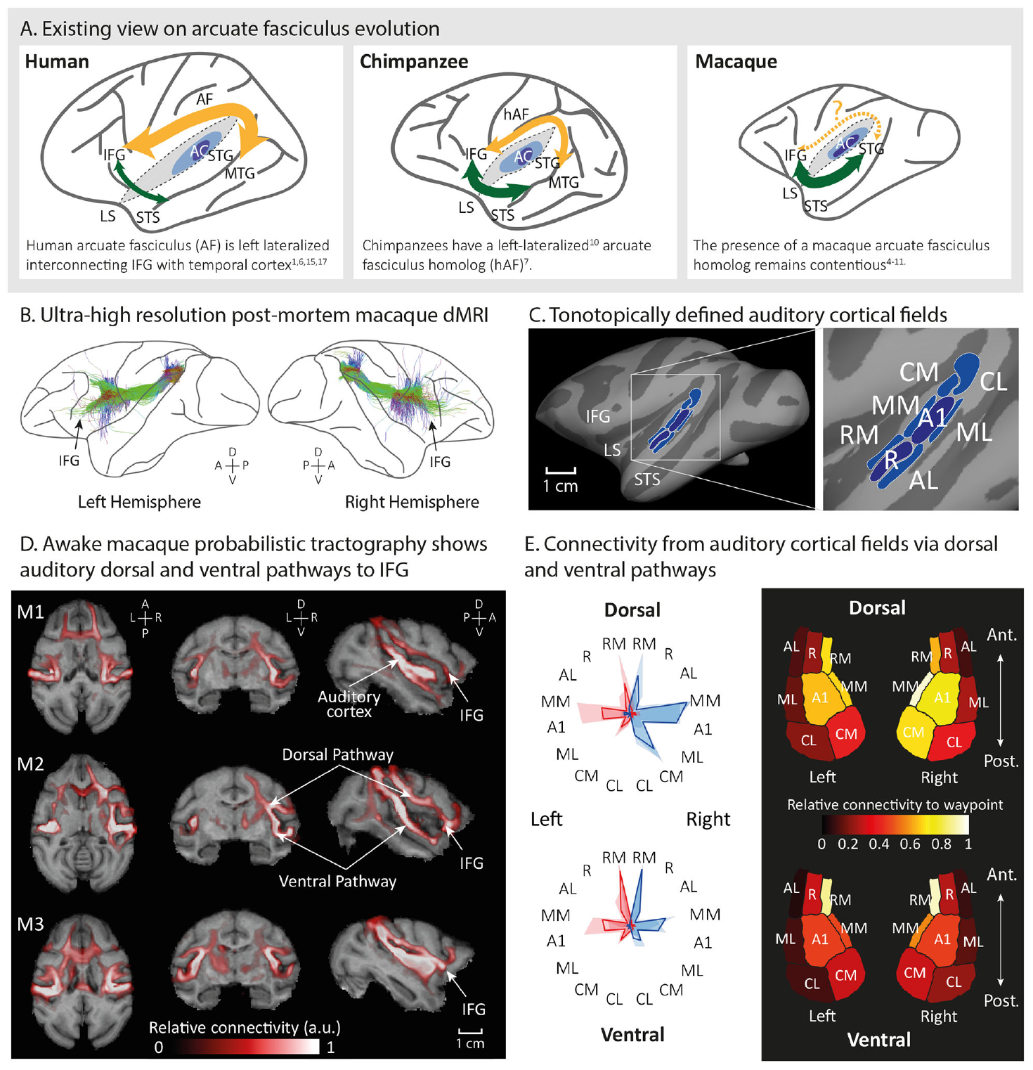
Macaques possess an auditory dorsal pathway
The arcuate fasciculus is a white-matter pathway linking temporal and frontal regions in primates. Balezeau and colleagues used diffusion magnetic resonance imaging and tractography to compare auditory pathways in macaques, chimpanzees and humans.
Tractography estimates fiber trajectories from the directional properties of water diffusion. In macaques, the analysis recovered a dorsal pathway associated with auditory cortical fields. The pathway had been underestimated by comparisons that used human language-related cortical targets as the only starting points.
The macaque finding places an auditory pathway prototype deeper in primate evolutionary history than a uniquely human account permits. It identifies anatomical connectivity rather than neural firing during communication. A tract's presence establishes a possible route for auditory-motor interaction, not a complete language circuit.
Balezeau et al. (2020), Fig. 1. Auditory fields and reconstructed macaque pathways
Balezeau et al. (2020)
27
Notes:
• The **arcuate fasciculus** is a white-matter pathway linking temporal and frontal regions in primates. Balezeau and colleagues used diffusion magnetic resonance imaging and tractography to compare auditory pathways in macaques, chimpanzees and humans.
• **Tractography** estimates fiber trajectories from the directional properties of water diffusion. In macaques, the analysis recovered a dorsal pathway associated with auditory cortical fields. The pathway had been underestimated by comparisons that used human language-related cortical targets as the only starting points.
• The macaque finding places an auditory pathway prototype deeper in primate evolutionary history than a uniquely human account permits. It identifies anatomical connectivity rather than neural firing during communication. A tract's presence establishes a possible route for auditory-motor interaction, not a complete language circuit.
References:
Balezeau F, Wilson B, Gallardo G, Dick F, Hopkins W, Anwander A, Friederici AD, Griffiths TD, Petkov CI (2020). Primate auditory prototype in the evolution of the arcuate fasciculus. Nature neuroscience 23:611-614. https://doi.org/10.1038/s41593-020-0623-9
Figure: Balezeau et al. (2020), Fig. 1. Auditory fields and reconstructed macaque pathways
Figure source: https://doi.org/10.1038/s41593-020-0623-9

Slide 28
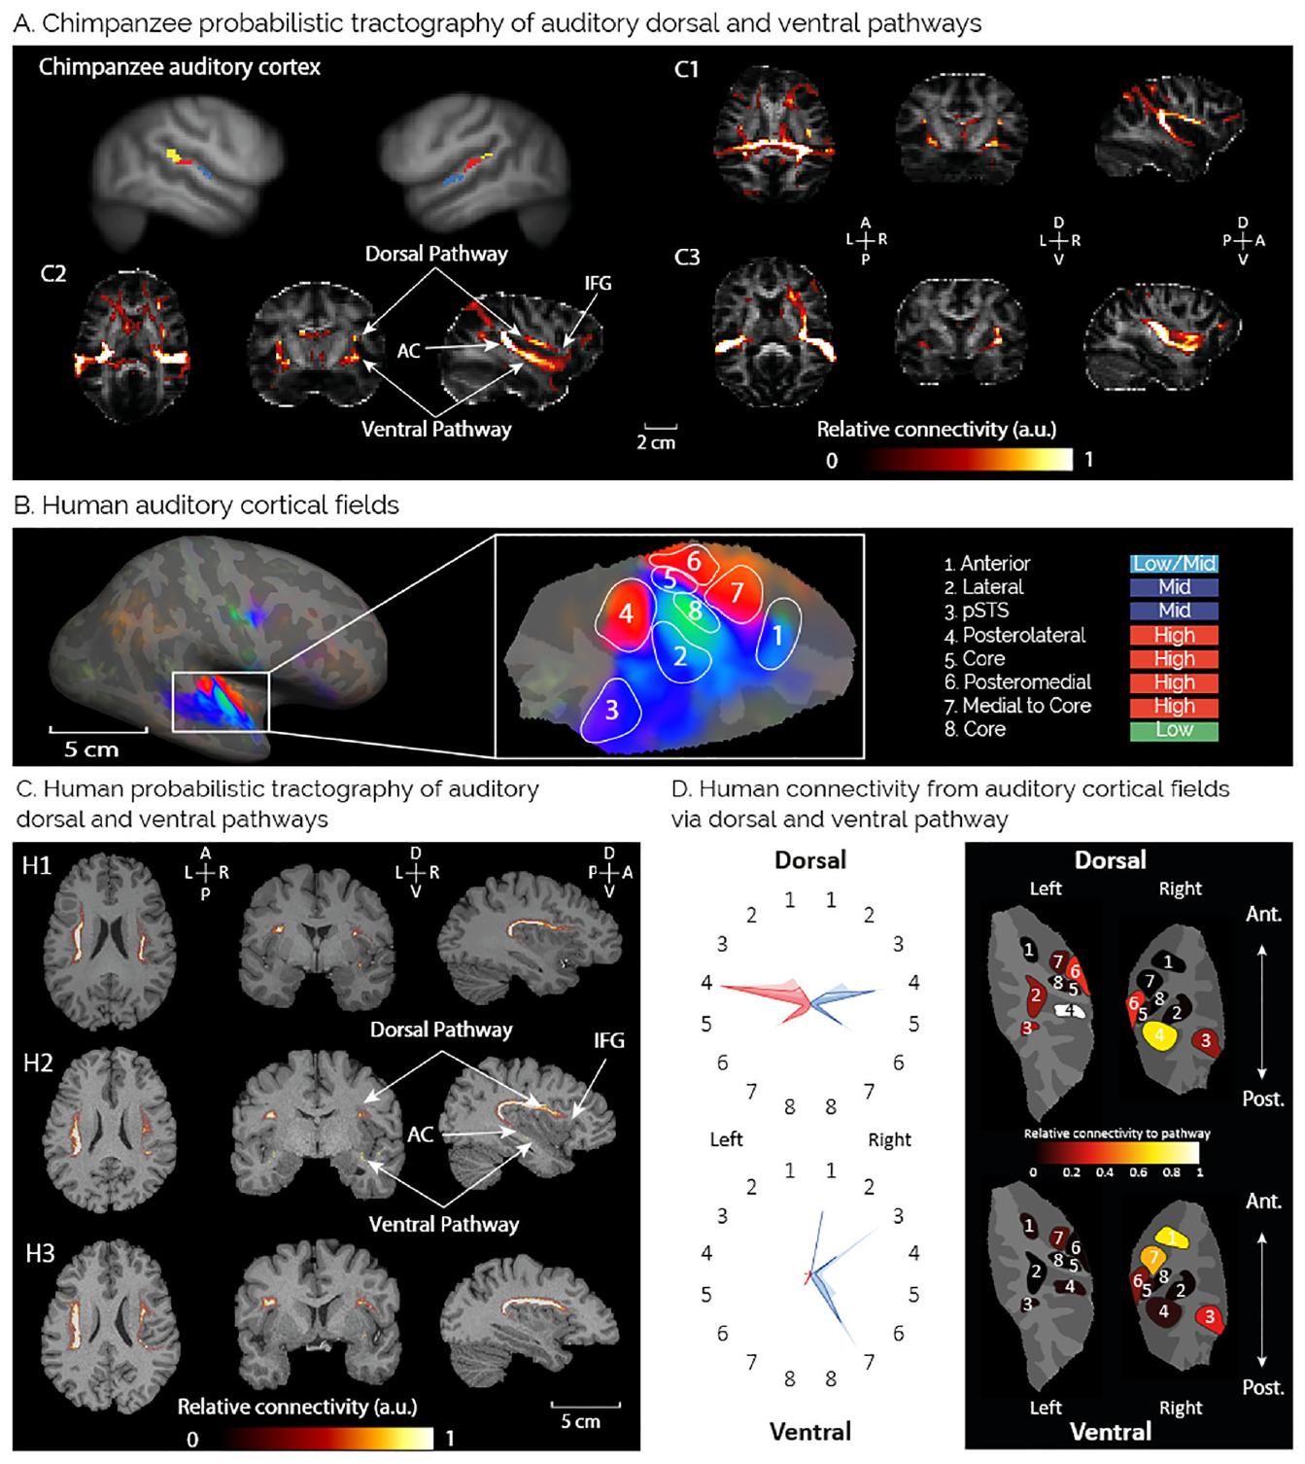
Auditory connections expand across primate lineages
A dorsal auditory pathway links sound-related temporal regions with frontal systems through a route above the temporal lobe. A ventral pathway follows a different route. Balezeau and colleagues compared these pathways using corresponding auditory regions across species.
Chimpanzee and human reconstructions had patterns distinct from macaque reconstructions, including broader dorsal connectivity toward frontal territories. The analysis retained species-specific auditory organization instead of treating the human cortical map as an exact template for every primate.
Changes in pathway extent can increase opportunities to couple heard sounds with planned actions. The anatomical comparison does not establish which connections are necessary for a particular word or gesture. Evolution of speech can involve modification of an existing auditory network rather than the sudden appearance of an entirely new white-matter tract.
Balezeau et al. (2020), Fig. 2. Chimpanzee and human auditory-pathway reconstructions
Balezeau et al. (2020)
28
Notes:
• A **dorsal auditory pathway** links sound-related temporal regions with frontal systems through a route above the temporal lobe. A ventral pathway follows a different route. Balezeau and colleagues compared these pathways using corresponding auditory regions across species.
• Chimpanzee and human reconstructions had patterns distinct from macaque reconstructions, including broader dorsal connectivity toward frontal territories. The analysis retained species-specific auditory organization instead of treating the human cortical map as an exact template for every primate.
• Changes in pathway extent can increase opportunities to couple heard sounds with planned actions. The anatomical comparison does not establish which connections are necessary for a particular word or gesture. Evolution of speech can involve modification of an existing auditory network rather than the sudden appearance of an entirely new white-matter tract.
References:
Balezeau F, Wilson B, Gallardo G, Dick F, Hopkins W, Anwander A, Friederici AD, Griffiths TD, Petkov CI (2020). Primate auditory prototype in the evolution of the arcuate fasciculus. Nature neuroscience 23:611-614. https://doi.org/10.1038/s41593-020-0623-9
Figure: Balezeau et al. (2020), Fig. 2. Chimpanzee and human auditory-pathway reconstructions
Figure source: https://doi.org/10.1038/s41593-020-0623-9

Slide 29
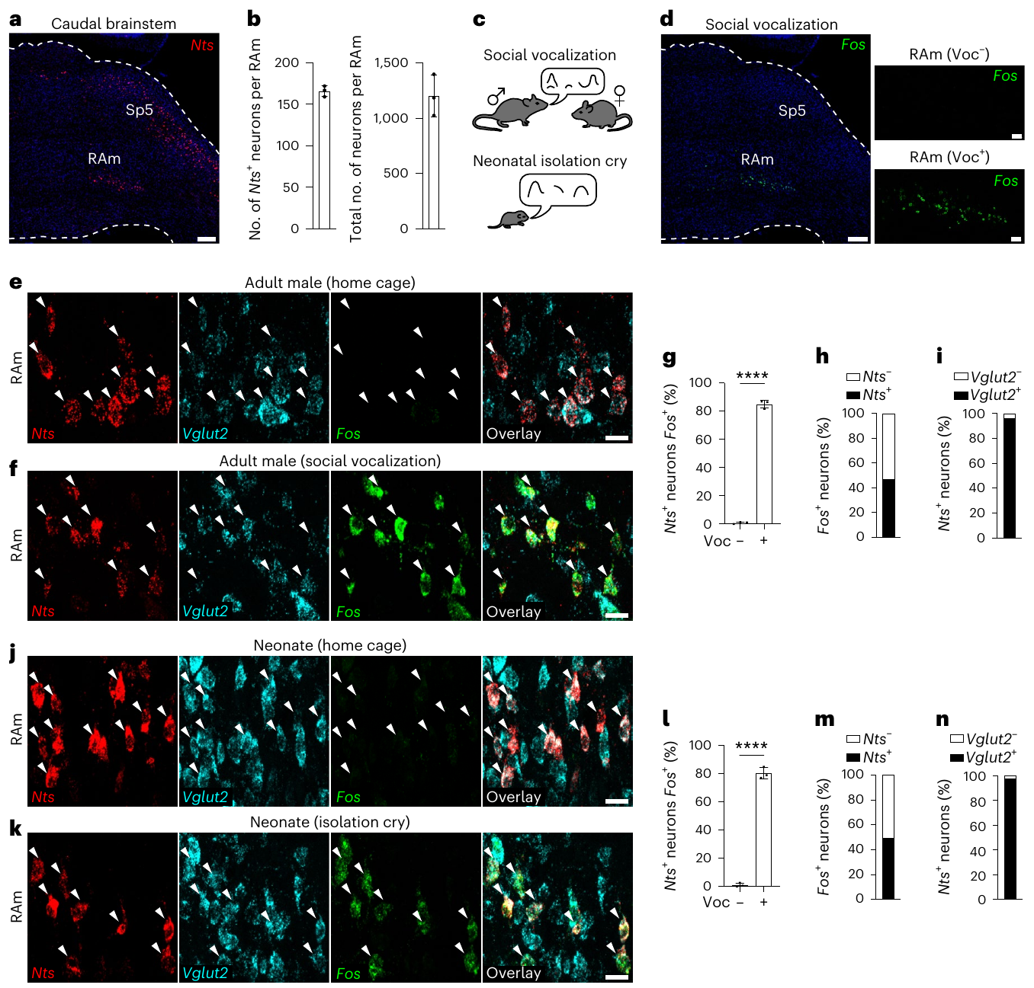
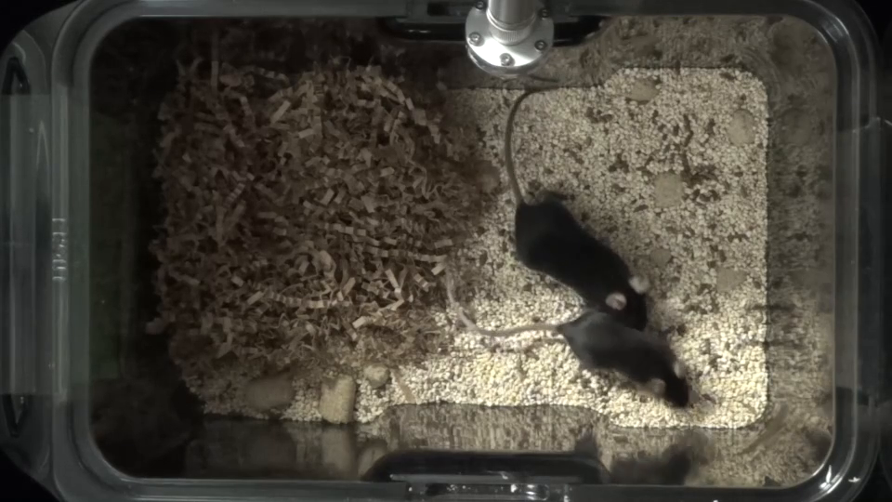
A mouse medullary population is active during calling
The nucleus retroambiguus, abbreviated RAm, is a medullary region near circuits controlling respiratory and laryngeal movements. Veerakumar and colleagues identified a subset expressing the gene for neurotensin, a signaling peptide, and measured activity-associated labeling during vocal behavior.
Nts expression served as a marker for experimentally targeting the population. Nts-marked cells were recruited during male social vocalization, with comparisons involving nonvocal behaviors. Gene expression identifies the targeted cells but does not establish that peptide release alone produces the observed vocalization.
Supplementary Video 1 records a mock-ablation control male investigating and following a female. Social investigation supplies a behavioral comparison for the manipulated animal. The recording is distinct from the ultrasonic spectrograms and histology used to quantify calling and identify the neural population.
Veerakumar et al. (2023), Fig. 1. Nts-marked RAm anatomy and activity-associated labeling
Click video to play in Slide Show. Veerakumar et al. (2023), Supplementary Video 1. A mock-ablation control male follows and investigates a female..
Veerakumar et al. (2023)
29
Notes:
• The **nucleus retroambiguus**, abbreviated RAm, is a medullary region near circuits controlling respiratory and laryngeal movements. Veerakumar and colleagues identified a subset expressing the gene for neurotensin, a signaling peptide, and measured activity-associated labeling during vocal behavior.
• **Nts** expression served as a marker for experimentally targeting the population. Nts-marked cells were recruited during male social vocalization, with comparisons involving nonvocal behaviors. Gene expression identifies the targeted cells but does not establish that peptide release alone produces the observed vocalization.
• Supplementary Video 1 records a mock-ablation control male investigating and following a female. Social investigation supplies a behavioral comparison for the manipulated animal. The recording is distinct from the ultrasonic spectrograms and histology used to quantify calling and identify the neural population.
References:
Veerakumar A, Head JP, Krasnow MA (2023). A brainstem circuit for phonation and volume control in mice. Nature neuroscience 26:2122-2130. https://doi.org/10.1038/s41593-023-01478-2
Figure: Veerakumar et al. (2023), Fig. 1. Nts-marked RAm anatomy and activity-associated labeling
Figure source: https://doi.org/10.1038/s41593-023-01478-2
Article-provided recording: Veerakumar et al. (2023), Supplementary Video 1. A mock-ablation control male follows and investigates a female..
• A mock-ablation control male follows and investigates a female. Original audio is preserved.
Article DOI: https://doi.org/10.1038/s41593-023-01478-2
Original media URL: https://pmc-oa-opendata.s3.amazonaws.com/PMC10689238.1/41593_2023_1478_MOESM2_ESM.mp4
Credit: Veerakumar A, Head JP, Krasnow MA (2023). A brainstem circuit for phonation and volume control in mice. Nature neuroscience 26:2122-2130. https://doi.org/10.1038/s41593-023-01478-2
License: Open Access This article is licensed under a Creative Commons Attribution 4.0 International License, which permits use, sharing, adaptation, distribution and reproduction in any medium or format, as long as you give appropriate credit to the original author(s) and the source, provide a link to the Creative Commons license, and indicate if changes were made. The images or other third party material in this article are included in the article’s Creative Commons license, unless indicated otherwise in a credit line to the material. If material is not included in the article’s Creative Commons license and your intended use is not permitted by statutory regulation or exceeds the permitted use, you will need to obtain permission directly from the copyright holder. To view a copy of this license, visit http://creativecommons.org/licenses/by/4.0/ .
Compatibility: H.264/yuv420p MP4; full scene, dimensions, source timing and original audio preserved. Any slow motion or annotations are supplied by the source authors.
Playback: click the recording in PowerPoint Slide Show. The credited original article figure remains a static fallback. Full media decode and embedded relationships were checked; interactive PowerPoint playback was unavailable in this environment.

Slide 30
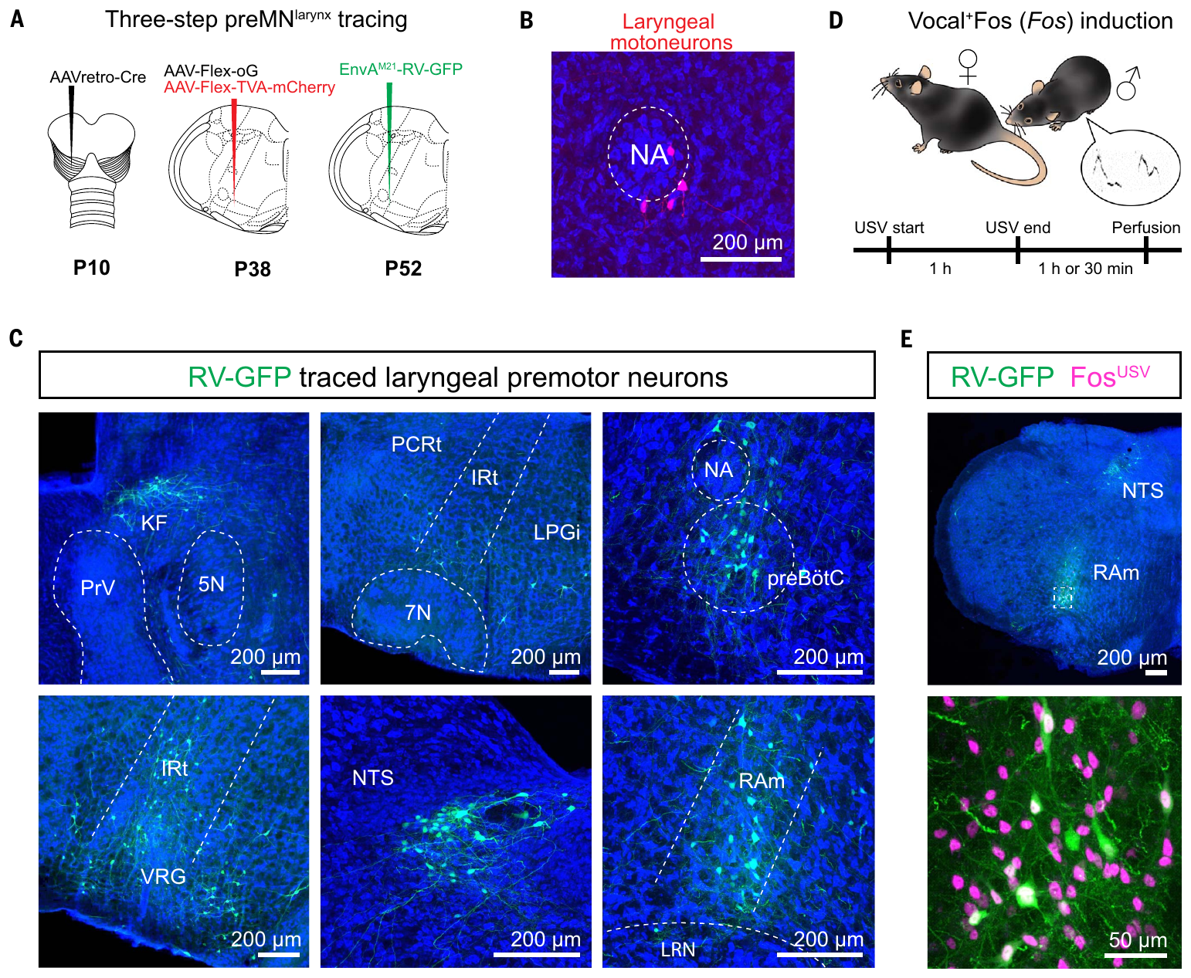
Tracing identifies premotor access to laryngeal muscles
A premotor neuron influences a motor neuron that innervates muscle. Park and colleagues traced connections from mouse laryngeal muscles to identify brainstem neurons positioned to regulate vocal-fold movement. Transsynaptic tracing crosses connected cells to map candidate pathways.
The nucleus ambiguus contains laryngeal motor neurons. Labeled premotor populations included RAm and other brainstem regions. Activity-dependent labeling during vocalization further narrowed the RAm population designated RAmVOC.
The anatomical chain connects muscle innervation to candidate upstream control cells. Activity labeling supplies a second criterion beyond connectivity alone. Neither tracing nor activity labeling independently establishes necessity, so the study subsequently tested the contribution of the identified population with targeted disruption and stimulation.
Park et al. (2024), Fig. 1. Laryngeal tracing and fluorescent brainstem anatomy
Park et al. (2024)
30
Notes:
• A **premotor neuron** influences a motor neuron that innervates muscle. Park and colleagues traced connections from mouse laryngeal muscles to identify brainstem neurons positioned to regulate vocal-fold movement. Transsynaptic tracing crosses connected cells to map candidate pathways.
• The **nucleus ambiguus** contains laryngeal motor neurons. Labeled premotor populations included RAm and other brainstem regions. Activity-dependent labeling during vocalization further narrowed the RAm population designated RAmVOC.
• The anatomical chain connects muscle innervation to candidate upstream control cells. Activity labeling supplies a second criterion beyond connectivity alone. Neither tracing nor activity labeling independently establishes necessity, so the study subsequently tested the contribution of the identified population with targeted disruption and stimulation.
References:
Park J, Choi S, Takatoh J, Zhao S, Harrahill A, Han BX, Wang F (2024). Brainstem control of vocalization and its coordination with respiration. Science (New York, N.Y.) 383:eadi8081. https://doi.org/10.1126/science.adi8081
Figure: Park et al. (2024), Fig. 1. Laryngeal tracing and fluorescent brainstem anatomy
Figure source: https://doi.org/10.1126/science.adi8081

Slide 31
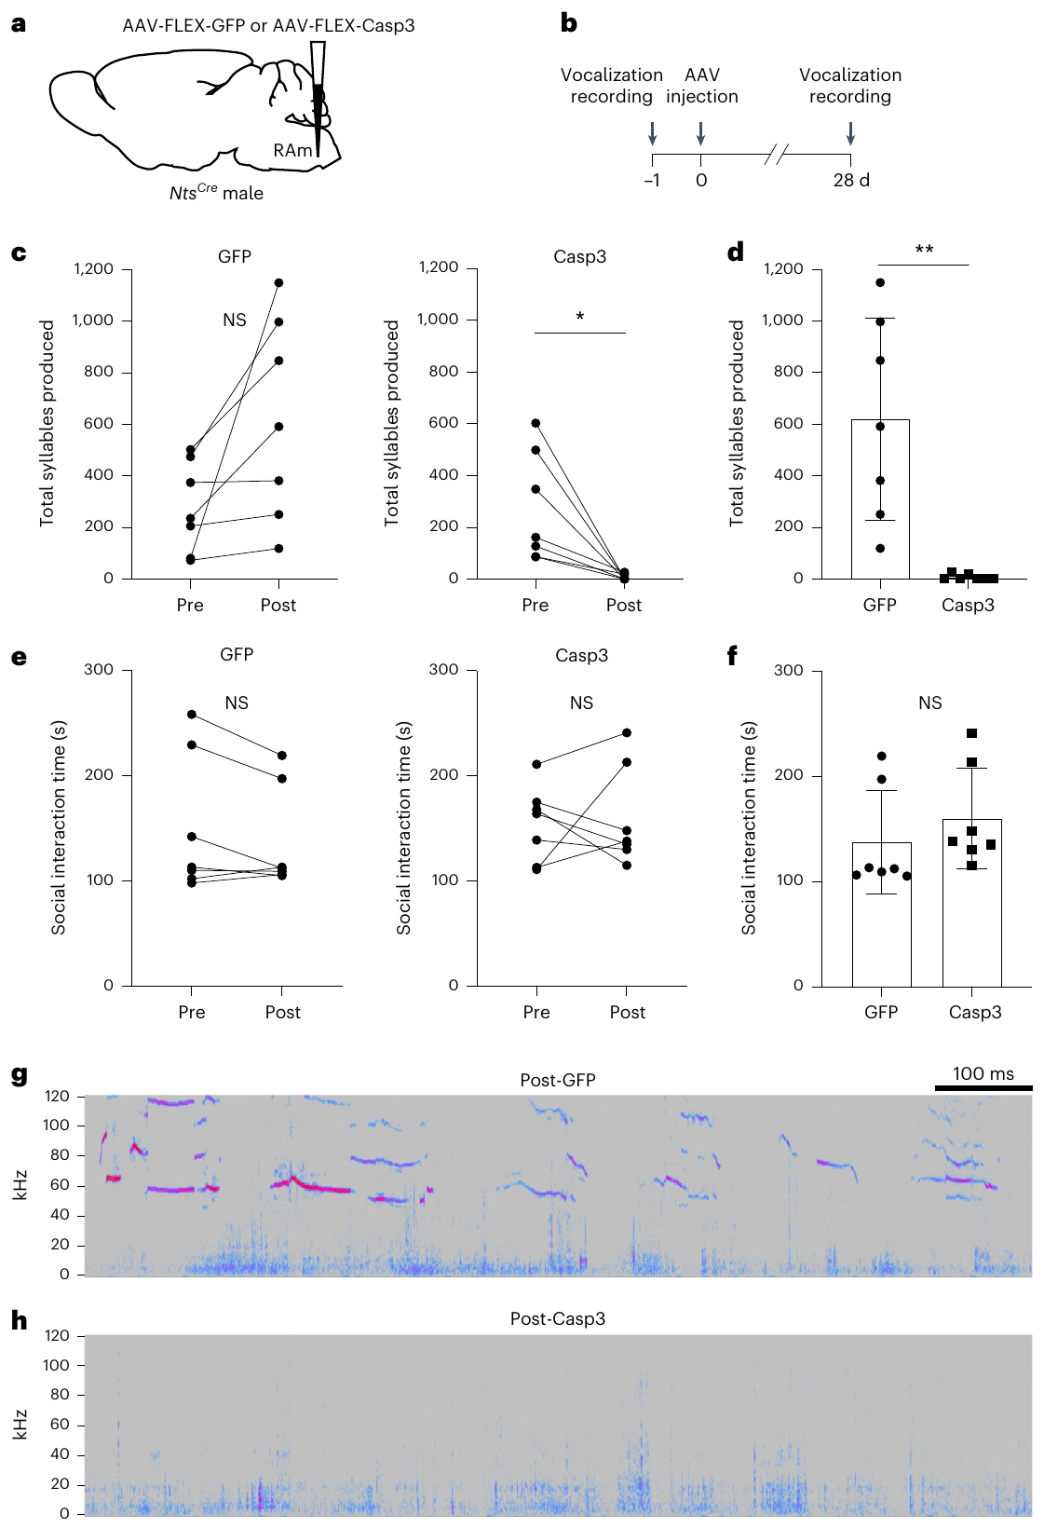
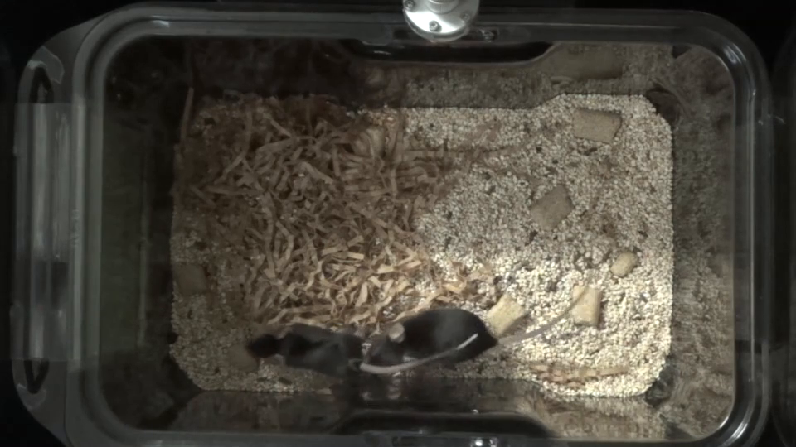
Ablation reduces calling while social pursuit persists
Ablation removes a targeted cell population. Veerakumar and colleagues expressed an apoptosis-inducing construct in Nts-marked RAm neurons and compared the manipulated males with control animals. Histology and behavioral recordings linked the intervention to the identified brainstem population.
Targeted animals produced far fewer social ultrasonic vocalizations. They nevertheless continued investigating and following females, providing a comparison against a general loss of social approach. The vocal effect was therefore separable from the continued presence of the interaction that normally accompanies calling.
Supplementary Video 2 records the ablation condition during female-directed behavior. Its source audio is preserved. Mouse ultrasonic vocalizations require appropriate acoustic analysis because much of their energy lies beyond human hearing; ordinary audible playback alone is not a complete measure of vocal output.
Veerakumar et al. (2023), Fig. 2. Ablation procedure and measured social vocalization effects
Veerakumar et al. (2023), Fig. 1. Histological identification of the RAm population
Click video to play in Slide Show. Veerakumar et al. (2023), Supplementary Video 2. An Nts-neuron-ablated male follows and investigates a female despite reduced measured calling..
Veerakumar et al. (2023)
31
Notes:
• **Ablation** removes a targeted cell population. Veerakumar and colleagues expressed an apoptosis-inducing construct in Nts-marked RAm neurons and compared the manipulated males with control animals. Histology and behavioral recordings linked the intervention to the identified brainstem population.
• Targeted animals produced far fewer social ultrasonic vocalizations. They nevertheless continued investigating and following females, providing a comparison against a general loss of social approach. The vocal effect was therefore separable from the continued presence of the interaction that normally accompanies calling.
• Supplementary Video 2 records the ablation condition during female-directed behavior. Its source audio is preserved. Mouse ultrasonic vocalizations require appropriate acoustic analysis because much of their energy lies beyond human hearing; ordinary audible playback alone is not a complete measure of vocal output.
References:
Veerakumar A, Head JP, Krasnow MA (2023). A brainstem circuit for phonation and volume control in mice. Nature neuroscience 26:2122-2130. https://doi.org/10.1038/s41593-023-01478-2
Figure: Veerakumar et al. (2023), Fig. 2. Ablation procedure and measured social vocalization effects
Figure source: https://doi.org/10.1038/s41593-023-01478-2
Figure: Veerakumar et al. (2023), Fig. 1. Histological identification of the RAm population
Figure source: https://doi.org/10.1038/s41593-023-01478-2
Article-provided recording: Veerakumar et al. (2023), Supplementary Video 2. An Nts-neuron-ablated male follows and investigates a female despite reduced measured calling..
• An Nts-neuron-ablated male follows and investigates a female despite reduced measured calling. Original audio is preserved.
Article DOI: https://doi.org/10.1038/s41593-023-01478-2
Original media URL: https://pmc-oa-opendata.s3.amazonaws.com/PMC10689238.1/41593_2023_1478_MOESM3_ESM.mp4
Credit: Veerakumar A, Head JP, Krasnow MA (2023). A brainstem circuit for phonation and volume control in mice. Nature neuroscience 26:2122-2130. https://doi.org/10.1038/s41593-023-01478-2
License: Open Access This article is licensed under a Creative Commons Attribution 4.0 International License, which permits use, sharing, adaptation, distribution and reproduction in any medium or format, as long as you give appropriate credit to the original author(s) and the source, provide a link to the Creative Commons license, and indicate if changes were made. The images or other third party material in this article are included in the article’s Creative Commons license, unless indicated otherwise in a credit line to the material. If material is not included in the article’s Creative Commons license and your intended use is not permitted by statutory regulation or exceeds the permitted use, you will need to obtain permission directly from the copyright holder. To view a copy of this license, visit http://creativecommons.org/licenses/by/4.0/ .
Compatibility: H.264/yuv420p MP4; full scene, dimensions, source timing and original audio preserved. Any slow motion or annotations are supplied by the source authors.
Playback: click the recording in PowerPoint Slide Show. The credited original article figure remains a static fallback. Full media decode and embedded relationships were checked; interactive PowerPoint playback was unavailable in this environment.

Slide 32
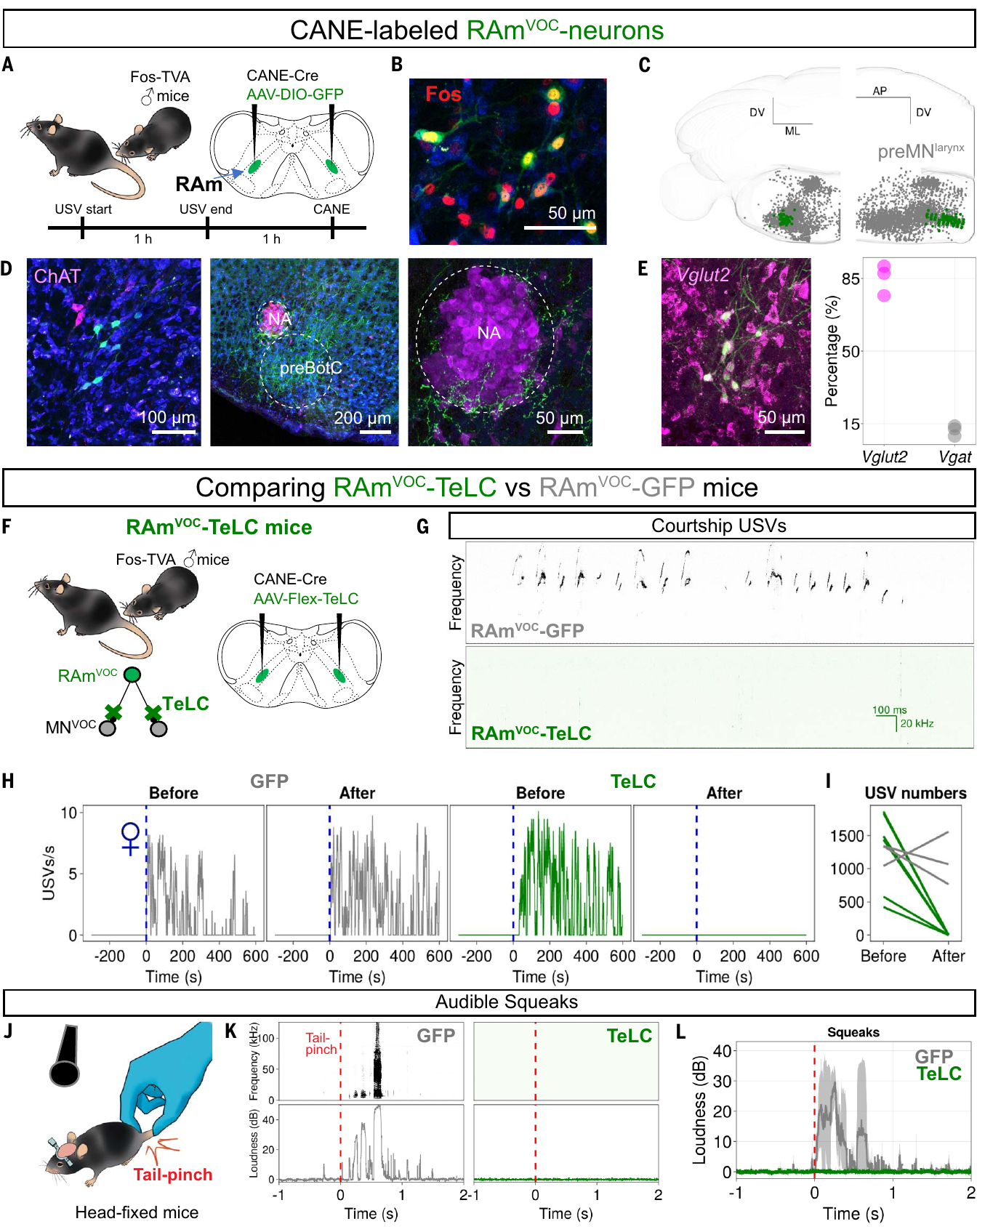
Blocking transmitter release suppresses vocal output
Park and colleagues expressed tetanus toxin light chain, or TeLC, in activity-defined RAmVOC neurons. TeLC disrupts vesicular transmitter release, allowing the contribution of the population's synaptic output to be tested without treating all nearby medullary cells as equivalent.
Glutamate, the transmitter associated with these excitatory neurons, links premotor firing to downstream excitation. The manipulation suppressed female-directed ultrasonic vocalizations and audible responses to aversive stimulation. Comparisons with control expression and retained nonvocal movements separated the vocal deficit from a complete inability to move or respond to the surrounding situation.
RAmVOC cells formed an excitatory laryngeal premotor population. Excitatory synaptic transmission increases the probability that downstream neurons fire. The result connects a verified interruption of that population's output to the failure to generate calls across distinct eliciting contexts.
Park et al. (2024), Fig. 2. RAmVOC histology and synaptic-blockade comparisons
Park et al. (2024)
32
Notes:
• Park and colleagues expressed **tetanus toxin light chain**, or TeLC, in activity-defined RAmVOC neurons. TeLC disrupts vesicular transmitter release, allowing the contribution of the population's synaptic output to be tested without treating all nearby medullary cells as equivalent.
• **Glutamate**, the transmitter associated with these excitatory neurons, links premotor firing to downstream excitation. The manipulation suppressed female-directed ultrasonic vocalizations and audible responses to aversive stimulation. Comparisons with control expression and retained nonvocal movements separated the vocal deficit from a complete inability to move or respond to the surrounding situation.
• RAmVOC cells formed an excitatory laryngeal premotor population. Excitatory synaptic transmission increases the probability that downstream neurons fire. The result connects a verified interruption of that population's output to the failure to generate calls across distinct eliciting contexts.
References:
Park J, Choi S, Takatoh J, Zhao S, Harrahill A, Han BX, Wang F (2024). Brainstem control of vocalization and its coordination with respiration. Science (New York, N.Y.) 383:eadi8081. https://doi.org/10.1126/science.adi8081
Figure: Park et al. (2024), Fig. 2. RAmVOC histology and synaptic-blockade comparisons
Figure source: https://doi.org/10.1126/science.adi8081

Slide 33
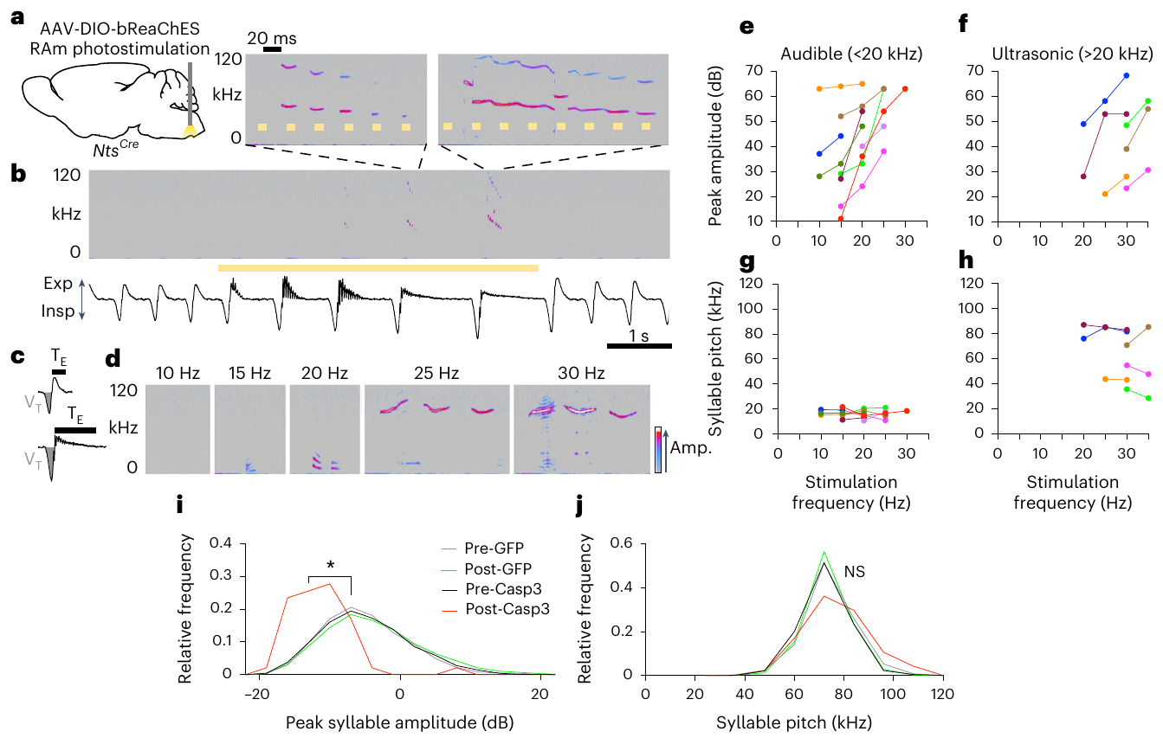
Light-driven activation recruits vocal motor output
Optogenetics uses a light-sensitive membrane protein to alter the activity of targeted neurons. Veerakumar and colleagues expressed channelrhodopsin in Nts-marked RAm cells. Channelrhodopsin opens a cation-conducting pathway when illuminated, depolarizing the targeted neurons.
Depolarization makes membrane voltage less negative and can trigger action potentials. Activating these cells produced vocal output and changed features related to vocal volume; increasing optical stimulation from 20 to 30 Hz could shift output toward the ultrasonic range. Control animals lacking the same light-sensitive construct allowed the contribution of light alone to be distinguished from targeted neural activation.
Stimulation links the defined population's activity to vocal production rather than only to social motivation. The natural temporal pattern of firing need not match the imposed optical pattern. Sufficiency under stimulation and necessity under ablation are complementary causal claims with different experimental meanings.
Veerakumar et al. (2023), Fig. 3. Optogenetic stimulation and induced acoustic output
Veerakumar et al. (2023), Fig. 1. RAm location and fluorescent cell identification
Veerakumar et al. (2023)
33
Notes:
• **Optogenetics** uses a light-sensitive membrane protein to alter the activity of targeted neurons. Veerakumar and colleagues expressed channelrhodopsin in Nts-marked RAm cells. Channelrhodopsin opens a cation-conducting pathway when illuminated, depolarizing the targeted neurons.
• **Depolarization** makes membrane voltage less negative and can trigger action potentials. Activating these cells produced vocal output and changed features related to vocal volume; increasing optical stimulation from **20 to 30 Hz** could shift output toward the ultrasonic range. Control animals lacking the same light-sensitive construct allowed the contribution of light alone to be distinguished from targeted neural activation.
• Stimulation links the defined population's activity to vocal production rather than only to social motivation. The natural temporal pattern of firing need not match the imposed optical pattern. Sufficiency under stimulation and necessity under ablation are complementary causal claims with different experimental meanings.
References:
Veerakumar A, Head JP, Krasnow MA (2023). A brainstem circuit for phonation and volume control in mice. Nature neuroscience 26:2122-2130. https://doi.org/10.1038/s41593-023-01478-2
Figure: Veerakumar et al. (2023), Fig. 3. Optogenetic stimulation and induced acoustic output
Figure source: https://doi.org/10.1038/s41593-023-01478-2
Figure: Veerakumar et al. (2023), Fig. 1. RAm location and fluorescent cell identification
Figure source: https://doi.org/10.1038/s41593-023-01478-2

Slide 34
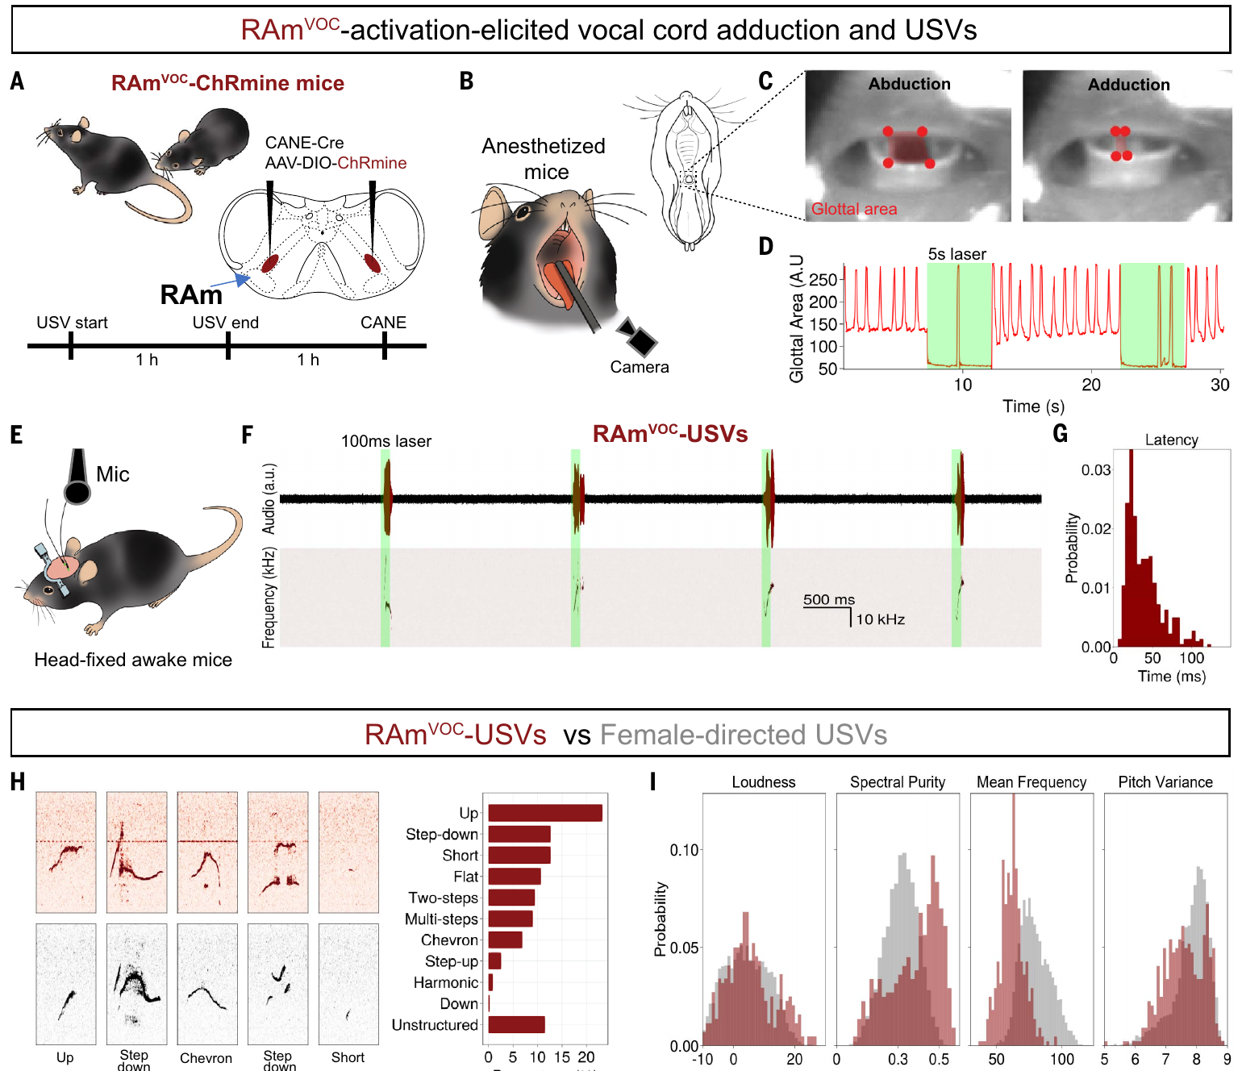
Premotor activation closes the vocal folds
Adduction is movement toward the midline; laryngeal adduction brings the vocal folds closer together. Park and colleagues optogenetically activated RAmVOC neurons and monitored laryngeal movement and sound production.
Activation produced vocal-fold closure and ultrasonic vocal output. Electromyography records electrical activity associated with muscle activation, providing a link between neural stimulation and motor recruitment. The experiment therefore connects an identified premotor population with the movement required for mouse vocalization.
Mouse ultrasonic sound production differs physically from ordinary human voiced speech, so the acoustic output cannot be treated as articulated speech. The shared control problem is coordination of laryngeal movement with airflow. A homologous motor-control component can contribute to different species-specific sound-production mechanisms.
Park et al. (2024), Fig. 3. Vocal-fold adduction and acoustic responses during stimulation
Park et al. (2024)
34
Notes:
• **Adduction** is movement toward the midline; laryngeal adduction brings the vocal folds closer together. Park and colleagues optogenetically activated RAmVOC neurons and monitored laryngeal movement and sound production.
• Activation produced vocal-fold closure and ultrasonic vocal output. **Electromyography** records electrical activity associated with muscle activation, providing a link between neural stimulation and motor recruitment. The experiment therefore connects an identified premotor population with the movement required for mouse vocalization.
• Mouse ultrasonic sound production differs physically from ordinary human voiced speech, so the acoustic output cannot be treated as articulated speech. The shared control problem is coordination of laryngeal movement with airflow. A homologous motor-control component can contribute to different species-specific sound-production mechanisms.
References:
Park J, Choi S, Takatoh J, Zhao S, Harrahill A, Han BX, Wang F (2024). Brainstem control of vocalization and its coordination with respiration. Science (New York, N.Y.) 383:eadi8081. https://doi.org/10.1126/science.adi8081
Figure: Park et al. (2024), Fig. 3. Vocal-fold adduction and acoustic responses during stimulation
Figure source: https://doi.org/10.1126/science.adi8081

Slide 35
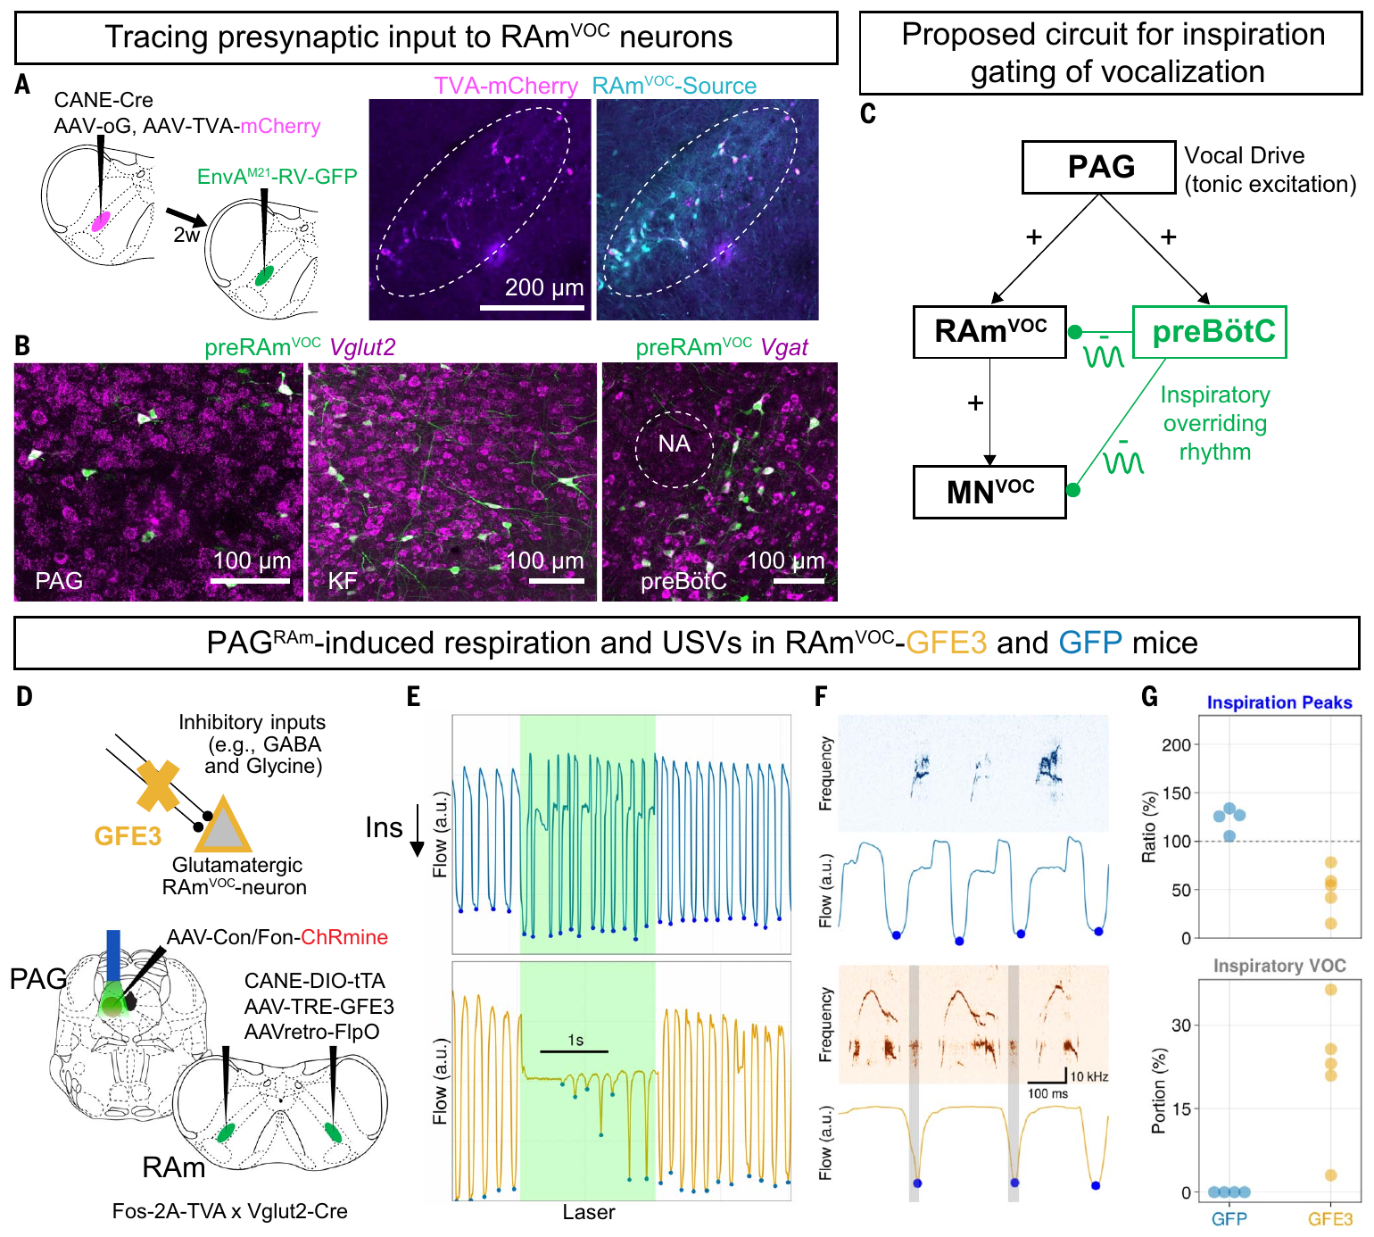
Inspiratory inhibition overrides vocal-fold closure
The preBötzinger complex is a medullary network involved in generating inspiratory rhythm. Park and colleagues identified inhibitory input from this region to the vocal premotor pathway. This creates a mechanism for coordinating the need to inhale with laryngeal closure during calling.
GABA and glycine are inhibitory transmitters associated with the proposed input. Their ionotropic receptors open chloride-conducting channels, increasing membrane conductance and suppressing firing in mature neurons. The experiment targeted the inhibitory-synapse scaffold gephyrin rather than isolating a single receptor subtype. Disrupting inhibitory synapses onto RAmVOC cells compromised the normal interruption of vocal-fold closure during inspiration. Respiratory requirements could no longer override the vocal command in the usual way.
The periaqueductal gray, a midbrain region, provides upstream access to the vocal pathway, while the respiratory network imposes phase-specific control. Anatomical tracing and targeted manipulations connect these structures to breathing and vocal output. This hierarchy explains a motor constraint on calling rather than the semantic content of a call.
Park et al. (2024), Fig. 5. Brainstem inputs and experimental respiratory gating
Park et al. (2024)
35
Notes:
• The **preBötzinger complex** is a medullary network involved in generating inspiratory rhythm. Park and colleagues identified inhibitory input from this region to the vocal premotor pathway. This creates a mechanism for coordinating the need to inhale with laryngeal closure during calling.
• **GABA** and **glycine** are inhibitory transmitters associated with the proposed input. Their ionotropic receptors open chloride-conducting channels, increasing membrane conductance and suppressing firing in mature neurons. The experiment targeted the inhibitory-synapse scaffold gephyrin rather than isolating a single receptor subtype. Disrupting inhibitory synapses onto RAmVOC cells compromised the normal interruption of vocal-fold closure during inspiration. Respiratory requirements could no longer override the vocal command in the usual way.
• The **periaqueductal gray**, a midbrain region, provides upstream access to the vocal pathway, while the respiratory network imposes phase-specific control. Anatomical tracing and targeted manipulations connect these structures to breathing and vocal output. This hierarchy explains a motor constraint on calling rather than the semantic content of a call.
References:
Park J, Choi S, Takatoh J, Zhao S, Harrahill A, Han BX, Wang F (2024). Brainstem control of vocalization and its coordination with respiration. Science (New York, N.Y.) 383:eadi8081. https://doi.org/10.1126/science.adi8081
Figure: Park et al. (2024), Fig. 5. Brainstem inputs and experimental respiratory gating
Figure source: https://doi.org/10.1126/science.adi8081

Slide 36
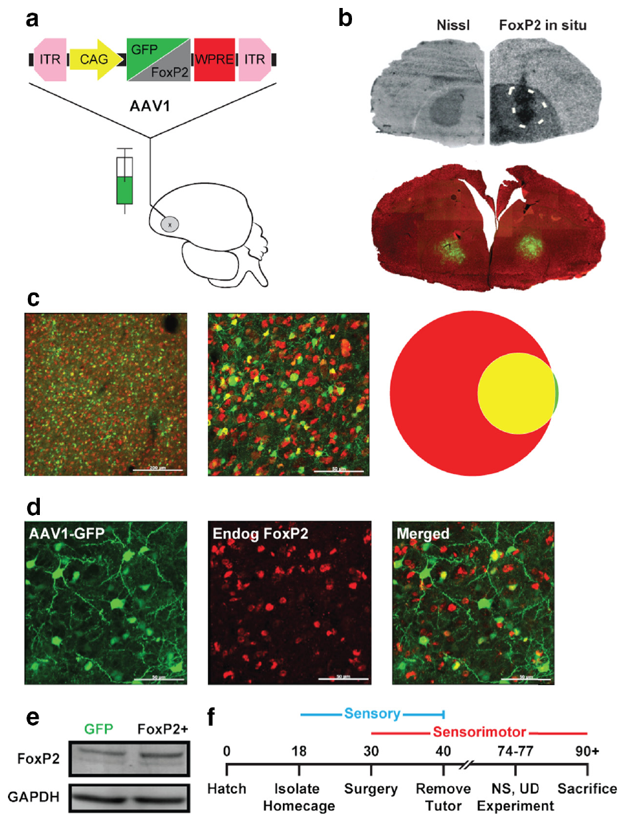
FoxP2 regulates a song-learning basal ganglia region
FoxP2 is a transcription factor, a protein that regulates the expression of other genes. Heston and White manipulated its expression in Area X, a song-related basal ganglia region of male zebra finches. The intervention targeted a circuit involved in learning from a tutor song.
A viral construct increased FoxP2 expression, while a control construct labeled the targeted region without the same regulatory manipulation. Fluorescent anatomy documented expression within Area X. Juvenile songs were recorded as the birds passed through the sensorimotor learning period.
A transcription factor can alter neuronal properties through changes in many downstream genes. It is therefore different from an ion channel that directly carries current across the membrane. The experiment tests regulation within a defined learning circuit, not a single gene encoding the acoustic pattern of the tutor's song.
Heston & White (2015), Fig. 1. Viral manipulation and Area X histology
Heston & White (2015)
36
Notes:
• **FoxP2** is a transcription factor, a protein that regulates the expression of other genes. Heston and White manipulated its expression in **Area X**, a song-related basal ganglia region of male zebra finches. The intervention targeted a circuit involved in learning from a tutor song.
• A viral construct increased FoxP2 expression, while a control construct labeled the targeted region without the same regulatory manipulation. Fluorescent anatomy documented expression within Area X. Juvenile songs were recorded as the birds passed through the sensorimotor learning period.
• A transcription factor can alter neuronal properties through changes in many downstream genes. It is therefore different from an ion channel that directly carries current across the membrane. The experiment tests regulation within a defined learning circuit, not a single gene encoding the acoustic pattern of the tutor's song.
References:
Heston JB, White SA (2015). Behavior-linked FoxP2 regulation enables zebra finch vocal learning. The Journal of neuroscience : the official journal of the Society for Neuroscience 35:2885-2894. https://doi.org/10.1523/jneurosci.3715-14.2015
Figure: Heston & White (2015), Fig. 1. Viral manipulation and Area X histology
Figure source: https://doi.org/10.1523/jneurosci.3715-14.2015

Slide 37
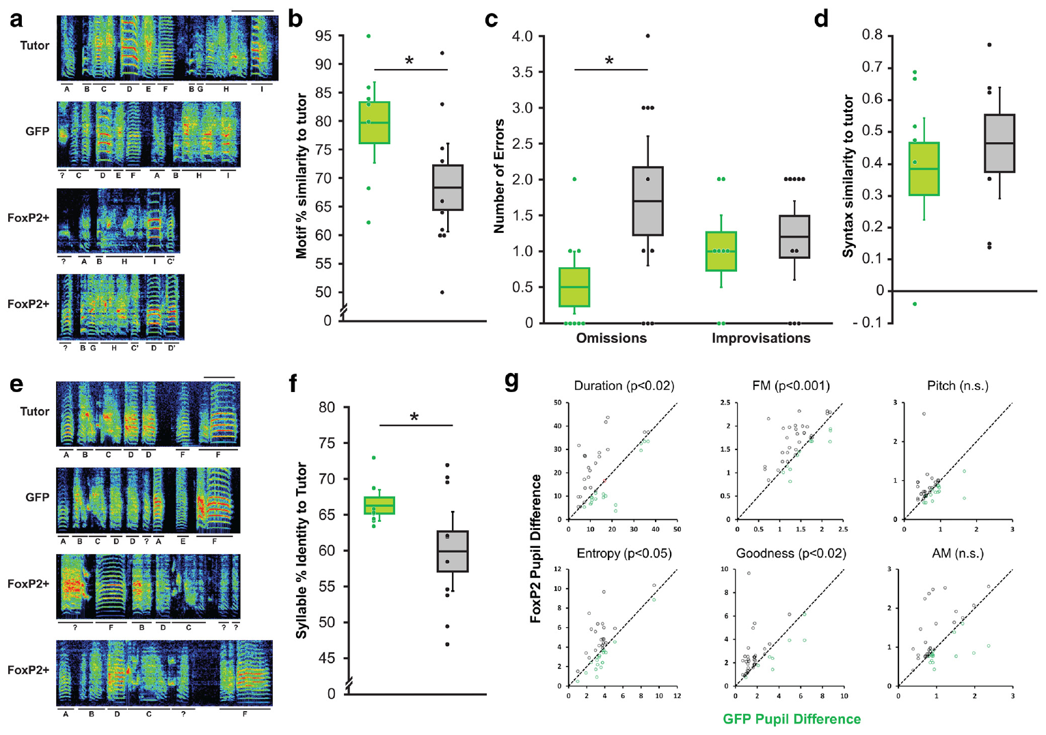
Persistently high FoxP2 impairs tutor-song imitation
Vocal imitation is acquisition of acoustic features from another individual's vocal output. Zebra finches normally refine their juvenile songs toward a memorized tutor model. Heston and White compared the developing songs of FoxP2-overexpressing birds with control birds and their tutors.
Overexpression impaired the eventual similarity of the pupil song to the tutor song. The intervention also disrupted behavior-linked changes in vocal variability during development. Variation supplies alternative motor outputs on which auditory feedback and learning can act.
The result implicates appropriately regulated FoxP2 in a learning circuit, rather than predicting that more FoxP2 always improves vocal ability. Bird song learning and human speech learning share some regulatory and circuit features while differing in their repertoires and social meanings. The experiment provides a mechanistic comparison across species.
Heston & White (2015), Fig. 2. Tutor and pupil spectrograms and imitation measurements
Heston & White (2015), Fig. 1. Targeted Area X anatomy
Heston & White (2015)
37
Notes:
• **Vocal imitation** is acquisition of acoustic features from another individual's vocal output. Zebra finches normally refine their juvenile songs toward a memorized tutor model. Heston and White compared the developing songs of FoxP2-overexpressing birds with control birds and their tutors.
• Overexpression impaired the eventual similarity of the pupil song to the tutor song. The intervention also disrupted behavior-linked changes in vocal variability during development. Variation supplies alternative motor outputs on which auditory feedback and learning can act.
• The result implicates appropriately regulated FoxP2 in a learning circuit, rather than predicting that more FoxP2 always improves vocal ability. Bird song learning and human speech learning share some regulatory and circuit features while differing in their repertoires and social meanings. The experiment provides a mechanistic comparison across species.
References:
Heston JB, White SA (2015). Behavior-linked FoxP2 regulation enables zebra finch vocal learning. The Journal of neuroscience : the official journal of the Society for Neuroscience 35:2885-2894. https://doi.org/10.1523/jneurosci.3715-14.2015
Figure: Heston & White (2015), Fig. 2. Tutor and pupil spectrograms and imitation measurements
Figure source: https://doi.org/10.1523/jneurosci.3715-14.2015
Figure: Heston & White (2015), Fig. 1. Targeted Area X anatomy
Figure source: https://doi.org/10.1523/jneurosci.3715-14.2015

Slide 38
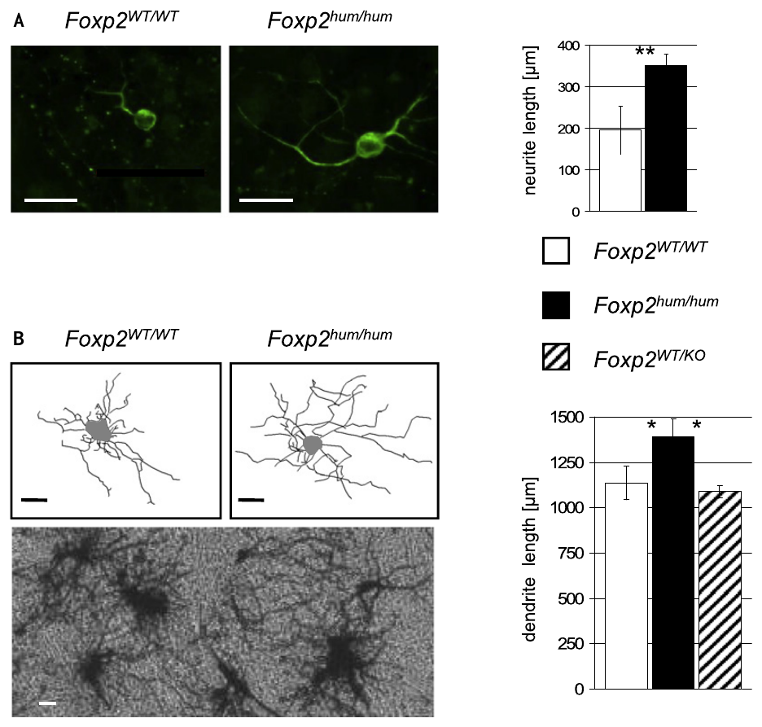
Humanized Foxp2 changes striatal neuronal morphology
A humanized allele is an experimentally modified gene version containing selected human sequence features. Enard and colleagues introduced two human-lineage amino acid substitutions into mouse Foxp2 and compared the resulting animals with genetically matched controls.
The striatum is a basal ganglia structure receiving cortical and dopaminergic input. Its medium spiny neurons have dendrites that receive synaptic signals. Neurons from the humanized animals developed longer dendritic trees in the reported comparisons, linking the sequence change to cellular morphology.
The allele also altered dopamine concentrations and other phenotypes, so its effects were not confined to vocal behavior. Dopamine is a transmitter that modulates neural activity and plasticity. These cellular effects identify consequences of the sequence substitutions in mice without transforming mouse vocalizations into human language.
Enard et al. (2009), Fig. 4. Striatal neuronal images and dendritic measurements
Enard et al. (2009)
38
Notes:
• A **humanized allele** is an experimentally modified gene version containing selected human sequence features. Enard and colleagues introduced two human-lineage amino acid substitutions into mouse Foxp2 and compared the resulting animals with genetically matched controls.
• The **striatum** is a basal ganglia structure receiving cortical and dopaminergic input. Its medium spiny neurons have dendrites that receive synaptic signals. Neurons from the humanized animals developed longer dendritic trees in the reported comparisons, linking the sequence change to cellular morphology.
• The allele also altered dopamine concentrations and other phenotypes, so its effects were not confined to vocal behavior. **Dopamine** is a transmitter that modulates neural activity and plasticity. These cellular effects identify consequences of the sequence substitutions in mice without transforming mouse vocalizations into human language.
References:
Enard W, Gehre S, Hammerschmidt K, Hölter SM, Blass T, Somel M, Brückner MK, Schreiweis C, Winter C, Sohr R, Becker L, Wiebe V, Nickel B, Giger T, Müller U, Groszer M, Adler T, Aguilar A, Bolle I, Calzada-Wack J, Dalke C, Ehrhardt N, Favor J, Fuchs H, Gailus-Durner V, Hans W, Hölzlwimmer G, Javaheri A, Kalaydjiev S, Kallnik M, Kling E, Kunder S, Mossbrugger I, Naton B, Racz I, Rathkolb B, Rozman J, Schrewe A, Busch DH, Graw J, Ivandic B, Klingenspor M, Klopstock T, Ollert M, Quintanilla-Martinez L, Schulz H, Wolf E, Wurst W, Zimmer A, Fisher SE, Morgenstern R, Arendt T, de Angelis MH, Fischer J, Schwarz J, Pääbo S (2009). A humanized version of Foxp2 affects cortico-basal ganglia circuits in mice. Cell 137:961-971. https://doi.org/10.1016/j.cell.2009.03.041
Figure: Enard et al. (2009), Fig. 4. Striatal neuronal images and dendritic measurements
Figure source: https://doi.org/10.1016/j.cell.2009.03.041

Slide 39
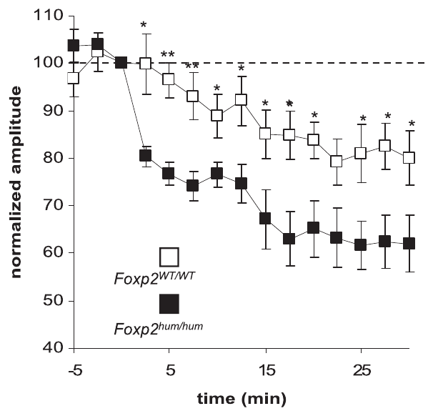
Humanized Foxp2 alters striatal synaptic plasticity
Synaptic plasticity is a lasting change in the effectiveness of communication between neurons. Enard and colleagues recorded medium spiny neurons in mouse striatal slices and measured the change in responses following a stimulation protocol that induces long-term depression.
Long-term depression, or LTD, is a persistent reduction in synaptic response strength. The humanized Foxp2 condition produced LTD that was almost twice as strong as the control condition. The electrophysiological comparison links the genetic manipulation to a measurable property of a cortico-basal ganglia circuit.
Dopaminergic modulation, neuronal morphology and plasticity all changed in the experiment, but the study did not establish a single receptor pathway explaining every phenotype. Foxp2 regulates a network of cellular functions. A plasticity difference supplies a candidate contribution to motor learning rather than evidence that mice acquired syntax.
Enard et al. (2009), Fig. 5. Striatal synaptic-response measurements after plasticity induction
Enard et al. (2009), Fig. 4. Medium spiny neuron morphology
Enard et al. (2009)
39
Notes:
• **Synaptic plasticity** is a lasting change in the effectiveness of communication between neurons. Enard and colleagues recorded medium spiny neurons in mouse striatal slices and measured the change in responses following a stimulation protocol that induces long-term depression.
• **Long-term depression**, or LTD, is a persistent reduction in synaptic response strength. The humanized Foxp2 condition produced LTD that was **almost twice as strong** as the control condition. The electrophysiological comparison links the genetic manipulation to a measurable property of a cortico-basal ganglia circuit.
• Dopaminergic modulation, neuronal morphology and plasticity all changed in the experiment, but the study did not establish a single receptor pathway explaining every phenotype. Foxp2 regulates a network of cellular functions. A plasticity difference supplies a candidate contribution to motor learning rather than evidence that mice acquired syntax.
References:
Enard W, Gehre S, Hammerschmidt K, Hölter SM, Blass T, Somel M, Brückner MK, Schreiweis C, Winter C, Sohr R, Becker L, Wiebe V, Nickel B, Giger T, Müller U, Groszer M, Adler T, Aguilar A, Bolle I, Calzada-Wack J, Dalke C, Ehrhardt N, Favor J, Fuchs H, Gailus-Durner V, Hans W, Hölzlwimmer G, Javaheri A, Kalaydjiev S, Kallnik M, Kling E, Kunder S, Mossbrugger I, Naton B, Racz I, Rathkolb B, Rozman J, Schrewe A, Busch DH, Graw J, Ivandic B, Klingenspor M, Klopstock T, Ollert M, Quintanilla-Martinez L, Schulz H, Wolf E, Wurst W, Zimmer A, Fisher SE, Morgenstern R, Arendt T, de Angelis MH, Fischer J, Schwarz J, Pääbo S (2009). A humanized version of Foxp2 affects cortico-basal ganglia circuits in mice. Cell 137:961-971. https://doi.org/10.1016/j.cell.2009.03.041
Figure: Enard et al. (2009), Fig. 5. Striatal synaptic-response measurements after plasticity induction
Figure source: https://doi.org/10.1016/j.cell.2009.03.041
Figure: Enard et al. (2009), Fig. 4. Medium spiny neuron morphology
Figure source: https://doi.org/10.1016/j.cell.2009.03.041

Slide 40
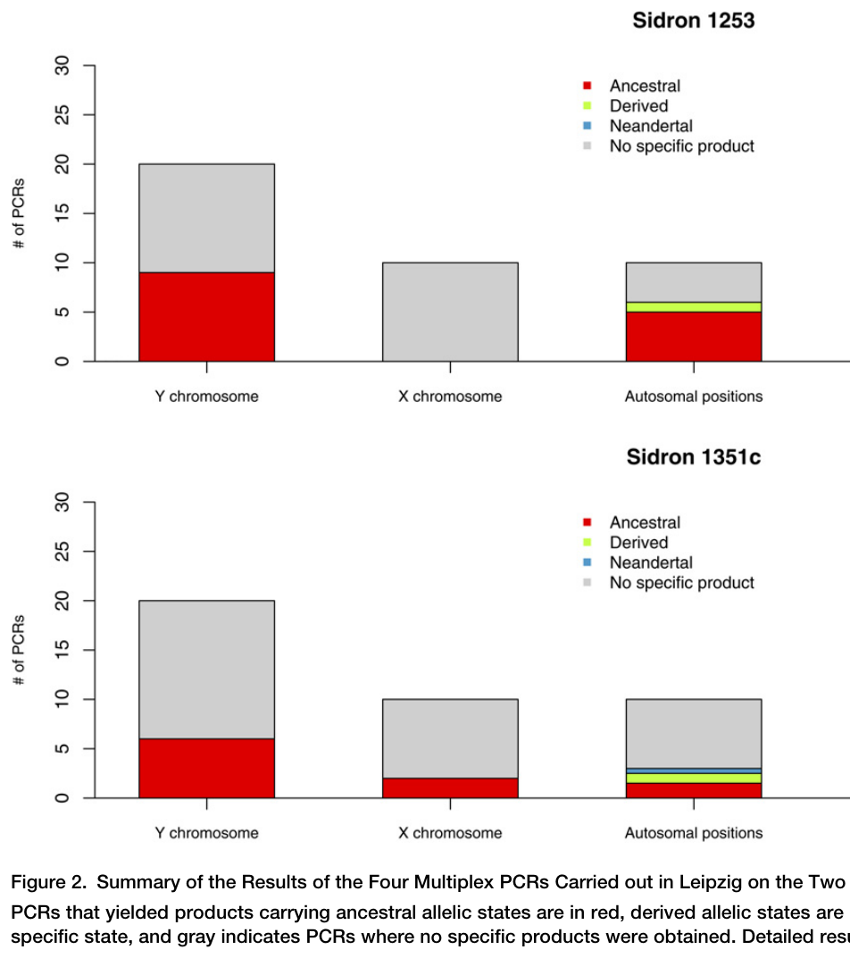
Neanderthals shared the derived FOXP2 coding variants
Ancient DNA consists of genetic material recovered from old biological remains. Krause and colleagues analyzed Neanderthal material for the two FOXP2 coding changes associated with the modern human lineage. Authentication and contamination checks were necessary because modern human DNA could produce a misleading apparent match.
The recovered Neanderthal sequence contained the derived variants. Comparisons across amplified fragments and associated genetic markers supported the attribution of the sequence to the ancient samples rather than simply assuming that every amplified fragment was authentic.
Sharing these coding variants removes a proposed genetic difference between Neanderthals and modern humans at those positions. It does not establish identical gene regulation, neural circuits or linguistic behavior. A transcription factor's sequence is one component of a developmental system, and language use cannot be directly read from two amino acid substitutions.
Krause et al. (2007), Fig. 2. Ancient-DNA amplification and authentication results
Krause et al. (2007)
40
Notes:
• **Ancient DNA** consists of genetic material recovered from old biological remains. Krause and colleagues analyzed Neanderthal material for the two FOXP2 coding changes associated with the modern human lineage. Authentication and contamination checks were necessary because modern human DNA could produce a misleading apparent match.
• The recovered Neanderthal sequence contained the derived variants. Comparisons across amplified fragments and associated genetic markers supported the attribution of the sequence to the ancient samples rather than simply assuming that every amplified fragment was authentic.
• Sharing these coding variants removes a proposed genetic difference between Neanderthals and modern humans at those positions. It does not establish identical gene regulation, neural circuits or linguistic behavior. A transcription factor's sequence is one component of a developmental system, and language use cannot be directly read from two amino acid substitutions.
References:
Krause J, Lalueza-Fox C, Orlando L, Enard W, Green RE, Burbano HA, Hublin JJ, Hänni C, Fortea J, de la Rasilla M, Bertranpetit J, Rosas A, Pääbo S (2007). The derived FOXP2 variant of modern humans was shared with Neandertals. Current biology : CB 17:1908-1912. https://doi.org/10.1016/j.cub.2007.10.008
Figure: Krause et al. (2007), Fig. 2. Ancient-DNA amplification and authentication results
Figure source: https://doi.org/10.1016/j.cub.2007.10.008

Slide 41
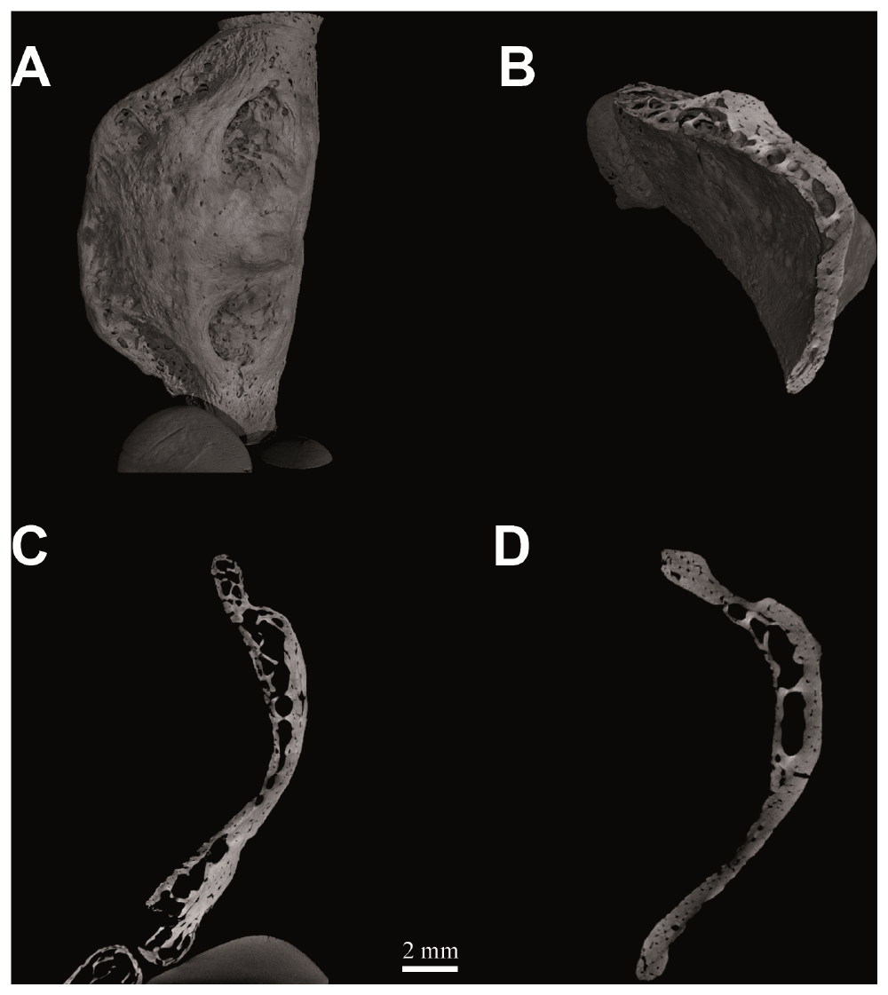
The Kebara hyoid supports a modern-like loading pattern
The hyoid is a bone supporting attachments of tongue and laryngeal musculature. D'Anastasio and colleagues examined the Kebara 2 Neanderthal hyoid using micro-computed tomography, which resolves internal structure through X-ray imaging.
The fossil's internal architecture was compared with modern human specimens. The study also used finite-element analysis, a computational method estimating how a structure distributes stress under specified loads. The inferred mechanical behavior was compatible with modern-like loading of the hyoid.
Anatomical similarity and modeled loading support the possibility of comparable functional demands. A fossil bone does not preserve the timing of its neural commands or the animal's vocabulary. The evidence concerns a component of the speech apparatus and cannot independently establish that Neanderthals spoke a particular kind of language.
D'Anastasio et al. (2013), Fig. 2. Kebara 2 hyoid tomography and internal architecture
D'Anastasio et al. (2013)
41
Notes:
• The **hyoid** is a bone supporting attachments of tongue and laryngeal musculature. D'Anastasio and colleagues examined the Kebara 2 Neanderthal hyoid using micro-computed tomography, which resolves internal structure through X-ray imaging.
• The fossil's internal architecture was compared with modern human specimens. The study also used finite-element analysis, a computational method estimating how a structure distributes stress under specified loads. The inferred mechanical behavior was compatible with modern-like loading of the hyoid.
• Anatomical similarity and modeled loading support the possibility of comparable functional demands. A fossil bone does not preserve the timing of its neural commands or the animal's vocabulary. The evidence concerns a component of the speech apparatus and cannot independently establish that Neanderthals spoke a particular kind of language.
References:
D'Anastasio R, Wroe S, Tuniz C, Mancini L, Cesana DT, Dreossi D, Ravichandiran M, Attard M, Parr WC, Agur A, Capasso L (2013). Micro-biomechanics of the Kebara 2 hyoid and its implications for speech in Neanderthals. PloS one 8:e82261. https://doi.org/10.1371/journal.pone.0082261
Figure: D'Anastasio et al. (2013), Fig. 2. Kebara 2 hyoid tomography and internal architecture
Figure source: https://doi.org/10.1371/journal.pone.0082261

Slide 42
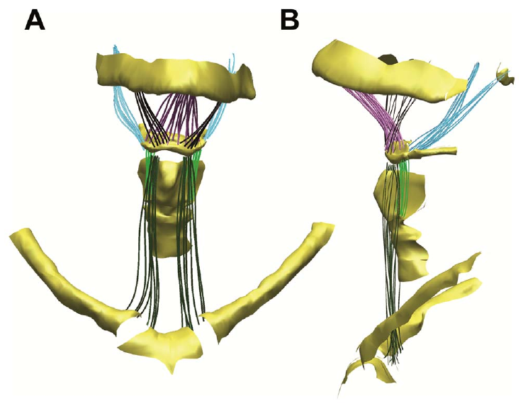
Muscle attachments connect the hyoid to vocal structures
Muscle attachment transfers force from a contracting muscle to the bones and tissues it connects. D'Anastasio and colleagues included a reconstruction of the hyoid musculature to specify the loading assumptions in their biomechanical analysis.
The hyoid participates in a mechanically linked system involving the tongue, mandible and laryngeal region. Different muscle forces can change the position or loading of this system during swallowing and vocal behavior. The published anatomical reconstruction distinguishes these attachments from the internal structure measured by tomography.
The mechanical analysis depends on the specified forces and constraints. Similar stress distributions support comparable loading under those conditions, rather than uniquely identifying speech as the behavior that produced the fossil architecture. Muscle attachment geometry supplies functional context for the bone without preserving the extinct animal's neural activation pattern.
D'Anastasio et al. (2013), Fig. 6. Published hyoid musculature reconstruction
D'Anastasio et al. (2013)
42
Notes:
• **Muscle attachment** transfers force from a contracting muscle to the bones and tissues it connects. D'Anastasio and colleagues included a reconstruction of the hyoid musculature to specify the loading assumptions in their biomechanical analysis.
• The hyoid participates in a mechanically linked system involving the tongue, mandible and laryngeal region. Different muscle forces can change the position or loading of this system during swallowing and vocal behavior. The published anatomical reconstruction distinguishes these attachments from the internal structure measured by tomography.
• The mechanical analysis depends on the specified forces and constraints. Similar stress distributions support comparable loading under those conditions, rather than uniquely identifying speech as the behavior that produced the fossil architecture. Muscle attachment geometry supplies functional context for the bone without preserving the extinct animal's neural activation pattern.
References:
D'Anastasio R, Wroe S, Tuniz C, Mancini L, Cesana DT, Dreossi D, Ravichandiran M, Attard M, Parr WC, Agur A, Capasso L (2013). Micro-biomechanics of the Kebara 2 hyoid and its implications for speech in Neanderthals. PloS one 8:e82261. https://doi.org/10.1371/journal.pone.0082261
Figure: D'Anastasio et al. (2013), Fig. 6. Published hyoid musculature reconstruction
Figure source: https://doi.org/10.1371/journal.pone.0082261

Slide 43


Reconstructed ears support a broad speech-relevant band
The external and middle ear transmit sound toward the inner ear. Conde-Valverde and colleagues reconstructed fossil ear anatomy from computed tomography and applied a model of sound-power transmission to compare Neanderthals, modern humans and earlier hominins.
Occupied bandwidth describes the modeled frequency interval containing most transmitted sound power. Neanderthal estimates were similar to modern human estimates and broader than those of the earlier Sima de los Huesos comparison. The interval includes frequencies important for distinguishing speech sounds.
The study reconstructs auditory transmission from preserved anatomy, rather than recording hearing from an extinct individual. Comparable transmission capacity supports the plausibility of effective vocal communication over a speech-relevant band. It is indirect evidence about perceptual capacity, not a record of words, grammatical rules or actual conversations.
Conde-Valverde et al. (2021), Fig. 1. Reconstructed ear structures
Conde-Valverde et al. (2021), Fig. 3. Modeled occupied bandwidth across fossil and living groups
Conde-Valverde et al. (2021)
43
Notes:
• The **external and middle ear** transmit sound toward the inner ear. Conde-Valverde and colleagues reconstructed fossil ear anatomy from computed tomography and applied a model of sound-power transmission to compare Neanderthals, modern humans and earlier hominins.
• **Occupied bandwidth** describes the modeled frequency interval containing most transmitted sound power. Neanderthal estimates were similar to modern human estimates and broader than those of the earlier Sima de los Huesos comparison. The interval includes frequencies important for distinguishing speech sounds.
• The study reconstructs auditory transmission from preserved anatomy, rather than recording hearing from an extinct individual. Comparable transmission capacity supports the plausibility of effective vocal communication over a speech-relevant band. It is indirect evidence about perceptual capacity, not a record of words, grammatical rules or actual conversations.
References:
Conde-Valverde M, Martínez I, Quam RM, Rosa M, Velez AD, Lorenzo C, Jarabo P, Bermúdez de Castro JM, Carbonell E, Arsuaga JL (2021). Neanderthals and Homo sapiens had similar auditory and speech capacities. Nature ecology & evolution 5:609-615. https://doi.org/10.1038/s41559-021-01391-6
Figure: Conde-Valverde et al. (2021), Fig. 1. Reconstructed ear structures
Figure source: https://doi.org/10.1038/s41559-021-01391-6
Figure: Conde-Valverde et al. (2021), Fig. 3. Modeled occupied bandwidth across fossil and living groups
Figure source: https://doi.org/10.1038/s41559-021-01391-6

Slide 44

Tool-making transmission can be tested experimentally
Cultural transmission is the acquisition of behavior through information from other individuals. Morgan and colleagues asked modern humans to learn Oldowan-style stone flaking under different transmission conditions, including observation, teaching and verbal instruction.
A transmission chain passes a learned skill from one learner to another. The study assessed products and technique as information moved along chains. The design compared access to an instructor's behavior with progressively richer forms of active guidance.
Oldowan stone tools are archaeological evidence of practiced production behavior. An experiment using modern participants tests which communication channels help transmit that behavior today. It does not directly reproduce the brains or social settings of early toolmakers, so modern verbal teaching benefits cannot date the origin of prehistoric language.
Morgan et al. (2015), Fig. 1. Experimental teaching conditions and transmission-chain design
Morgan et al. (2015)
44
Notes:
• **Cultural transmission** is the acquisition of behavior through information from other individuals. Morgan and colleagues asked modern humans to learn Oldowan-style stone flaking under different transmission conditions, including observation, teaching and verbal instruction.
• A **transmission chain** passes a learned skill from one learner to another. The study assessed products and technique as information moved along chains. The design compared access to an instructor's behavior with progressively richer forms of active guidance.
• Oldowan stone tools are archaeological evidence of practiced production behavior. An experiment using modern participants tests which communication channels help transmit that behavior today. It does not directly reproduce the brains or social settings of early toolmakers, so modern verbal teaching benefits cannot date the origin of prehistoric language.
References:
Morgan TJ, Uomini NT, Rendell LE, Chouinard-Thuly L, Street SE, Lewis HM, Cross CP, Evans C, Kearney R, de la Torre I, Whiten A, Laland KN (2015). Experimental evidence for the co-evolution of hominin tool-making teaching and language. Nature communications 6:6029. https://doi.org/10.1038/ncomms7029
Figure: Morgan et al. (2015), Fig. 1. Experimental teaching conditions and transmission-chain design
Figure source: https://doi.org/10.1038/ncomms7029

Slide 45

Teaching improves the transmission of stone-flaking skill
Teaching supplies information intended to change a learner's behavior. Morgan and colleagues compared the quality and number of usable flakes and other performance measures across transmission conditions. Gestural and verbal instruction provided information beyond passive observation of a model.
Richer teaching improved several measures of skill acquisition and transmission. Performance nevertheless changed along chains, so a benefit at one step did not eliminate information loss across successive learners. The original measurements connect communication conditions with the products of a concrete motor task.
The findings support a proposed co-evolutionary relationship among toolmaking, teaching and communication. Co-evolution means that changes in interacting traits influence one another over evolutionary time. The experiment establishes present-day transmission effects; the historical sequence linking stone technology and language remains an inference informed by archaeological and comparative evidence.
Morgan et al. (2015), Fig. 2. Original performance measurements across teaching conditions
Morgan et al. (2015)
45
Notes:
• **Teaching** supplies information intended to change a learner's behavior. Morgan and colleagues compared the quality and number of usable flakes and other performance measures across transmission conditions. Gestural and verbal instruction provided information beyond passive observation of a model.
• Richer teaching improved several measures of skill acquisition and transmission. Performance nevertheless changed along chains, so a benefit at one step did not eliminate information loss across successive learners. The original measurements connect communication conditions with the products of a concrete motor task.
• The findings support a proposed co-evolutionary relationship among toolmaking, teaching and communication. **Co-evolution** means that changes in interacting traits influence one another over evolutionary time. The experiment establishes present-day transmission effects; the historical sequence linking stone technology and language remains an inference informed by archaeological and comparative evidence.
References:
Morgan TJ, Uomini NT, Rendell LE, Chouinard-Thuly L, Street SE, Lewis HM, Cross CP, Evans C, Kearney R, de la Torre I, Whiten A, Laland KN (2015). Experimental evidence for the co-evolution of hominin tool-making teaching and language. Nature communications 6:6029. https://doi.org/10.1038/ncomms7029
Figure: Morgan et al. (2015), Fig. 2. Original performance measurements across teaching conditions
Figure source: https://doi.org/10.1038/ncomms7029

Slide 46
Key takeaways
Signal meaning. Context-linked calls and meaningful combinations establish components of communication; they do not by themselves establish human grammar.
Interaction management. Ape gaze and gestures coordinate entry and exit from shared activities, while marmoset calling exhibits auditory turn-taking.
Production control. Vocal output depends on coordinated respiratory pressure, laryngeal movement and vocal-tract shaping.
Neural pathways. Frontal action networks regulate call initiation; brainstem premotor circuits recruit laryngeal output and permit inspiratory interruption.
Vocal learning. Social feedback and appropriately regulated FoxP2 influence developmental vocal behavior and learning across mammalian and avian preparations.
Early-human evidence. Ancient FOXP2 variants, hyoid structure, ear transmission models and tool-teaching experiments constrain capacities without directly preserving prehistoric language.
Park et al. (2024); Krause et al. (2007); Conde-Valverde et al. (2021)
46
Notes:
• Signal meaning. Context-linked calls and meaningful combinations establish components of communication; they do not by themselves establish human grammar.
• Interaction management. Ape gaze and gestures coordinate entry and exit from shared activities, while marmoset calling exhibits auditory turn-taking.
• Production control. Vocal output depends on coordinated respiratory pressure, laryngeal movement and vocal-tract shaping.
• Neural pathways. Frontal action networks regulate call initiation; brainstem premotor circuits recruit laryngeal output and permit inspiratory interruption.
• Vocal learning. Social feedback and appropriately regulated FoxP2 influence developmental vocal behavior and learning across mammalian and avian preparations.
• Early-human evidence. Ancient FOXP2 variants, hyoid structure, ear transmission models and tool-teaching experiments constrain capacities without directly preserving prehistoric language.
References:
Ouattara K, Lemasson A, Zuberbühler K (2009). Campbell's monkeys concatenate vocalizations into context-specific call sequences. Proceedings of the National Academy of Sciences of the United States of America 106:22026-22031. https://doi.org/10.1073/pnas.0908118106
Heesen R, Bangerter A, Zuberbühler K, Iglesias K, Neumann C, Pajot A, Perrenoud L, Guéry JP, Rossano F, Genty E (2021). Assessing joint commitment as a process in great apes. iScience 24:102872. https://doi.org/10.1016/j.isci.2021.102872
Takahashi DY, Narayanan DZ, Ghazanfar AA (2013). Coupled oscillator dynamics of vocal turn-taking in monkeys. Current biology : CB 23:2162-2168. https://doi.org/10.1016/j.cub.2013.09.005
Zhang YS, Takahashi DY, Liao DA, Ghazanfar AA, Elemans CPH (2019). Vocal state change through laryngeal development. Nature communications 10:4592. https://doi.org/10.1038/s41467-019-12588-6
Park J, Choi S, Takatoh J, Zhao S, Harrahill A, Han BX, Wang F (2024). Brainstem control of vocalization and its coordination with respiration. Science (New York, N.Y.) 383:eadi8081. https://doi.org/10.1126/science.adi8081
Heston JB, White SA (2015). Behavior-linked FoxP2 regulation enables zebra finch vocal learning. The Journal of neuroscience : the official journal of the Society for Neuroscience 35:2885-2894. https://doi.org/10.1523/jneurosci.3715-14.2015
Krause J, Lalueza-Fox C, Orlando L, Enard W, Green RE, Burbano HA, Hublin JJ, Hänni C, Fortea J, de la Rasilla M, Bertranpetit J, Rosas A, Pääbo S (2007). The derived FOXP2 variant of modern humans was shared with Neandertals. Current biology : CB 17:1908-1912. https://doi.org/10.1016/j.cub.2007.10.008
D'Anastasio R, Wroe S, Tuniz C, Mancini L, Cesana DT, Dreossi D, Ravichandiran M, Attard M, Parr WC, Agur A, Capasso L (2013). Micro-biomechanics of the Kebara 2 hyoid and its implications for speech in Neanderthals. PloS one 8:e82261. https://doi.org/10.1371/journal.pone.0082261
Conde-Valverde M, Martínez I, Quam RM, Rosa M, Velez AD, Lorenzo C, Jarabo P, Bermúdez de Castro JM, Carbonell E, Arsuaga JL (2021). Neanderthals and Homo sapiens had similar auditory and speech capacities. Nature ecology & evolution 5:609-615. https://doi.org/10.1038/s41559-021-01391-6
Morgan TJ, Uomini NT, Rendell LE, Chouinard-Thuly L, Street SE, Lewis HM, Cross CP, Evans C, Kearney R, de la Torre I, Whiten A, Laland KN (2015). Experimental evidence for the co-evolution of hominin tool-making teaching and language. Nature communications 6:6029. https://doi.org/10.1038/ncomms7029

