Slide 1
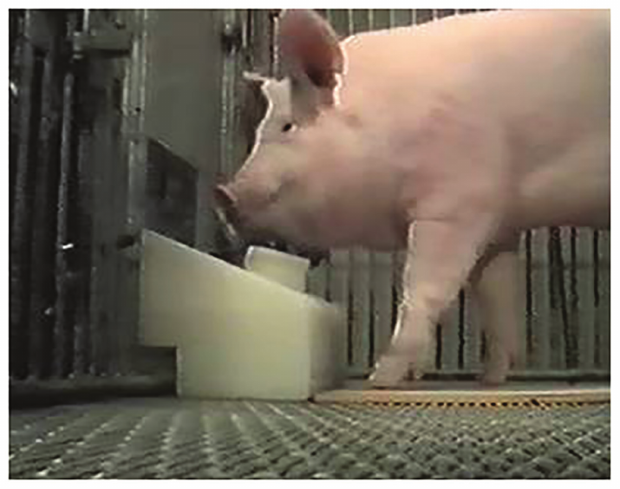
NEUR 411 · NEUROETHOLOGY · FALL 2026
Lecture 84
Animals in Virtual and Interactive Environments II:
Animals at the controls, joysticks, touchscreens, vehicles, and virtual games
Date TBD
Croney & Boysen (2021), Fig. 2. Pig using its snout to operate the joystick.
Jordan Lopez, Ph.D.
Professor of Neurobiology & Biomedical Engineering
Notes:
Animals in Virtual and Interactive Environments II: Animals at the controls, joysticks, touchscreens, vehicles, and virtual games
Lecture 84. NEUR 411 · NEUROETHOLOGY · FALL 2026. Date TBD.
Figure: Croney & Boysen (2021), Fig. 2. Pig using its snout to operate the joystick.
Figure source: https://doi.org/10.3389/fpsyg.2021.631755
References:
Croney CC, Boysen ST (2021). Acquisition of a Joystick-Operated Video Task by Pigs (Sus scrofa). Frontiers in Psychology 12:631755. https://doi.org/10.3389/fpsyg.2021.631755

Slide 2
Pigs learn to move a cursor with their snouts
A pig can learn to push a joystick so that a cursor reaches a target on a computer screen. Operant conditioning changes behavior through its consequences: a successful cursor movement produces food, increasing the probability of movements that reach the target.
Croney and Boysen adapted a primate video task for pigs. The animal's snout moved the joystick while its eyes monitored a separate screen. Successful control therefore linked a physical movement to a remote visual consequence rather than to food directly beside the nose.
All pigs eventually selected one-wall targets more accurately than random initial movements would predict. Their performance depended on both learning the cursor relationship and physically directing the joystick toward the correct screen location.
Croney & Boysen (2021), Fig. 2. Pig using its snout to operate the joystick.
Croney & Boysen (2021)
02
Notes:
• A pig can learn to push a joystick so that a cursor reaches a target on a computer screen. Operant conditioning changes behavior through its consequences: a successful cursor movement produces food, increasing the probability of movements that reach the target.
• Croney and Boysen adapted a primate video task for pigs. The animal's snout moved the joystick while its eyes monitored a separate screen. Successful control therefore linked a physical movement to a remote visual consequence rather than to food directly beside the nose.
• All pigs eventually selected one-wall targets more accurately than random initial movements would predict. Their performance depended on both learning the cursor relationship and physically directing the joystick toward the correct screen location.
• The four-wall stage accepts contact with any border. Removing borders changes the need for initial direction selection, whereas shortening the remaining wall adds a precision requirement. The same food consequence can therefore shape different components of cursor control.
References:
Croney CC, Boysen ST (2021). Acquisition of a Joystick-Operated Video Task by Pigs (Sus scrofa). Frontiers in Psychology 12:631755. https://doi.org/10.3389/fpsyg.2021.631755
Figure: Croney & Boysen (2021), Fig. 2. Pig using its snout to operate the joystick.
Figure source: https://doi.org/10.3389/fpsyg.2021.631755

Slide 3
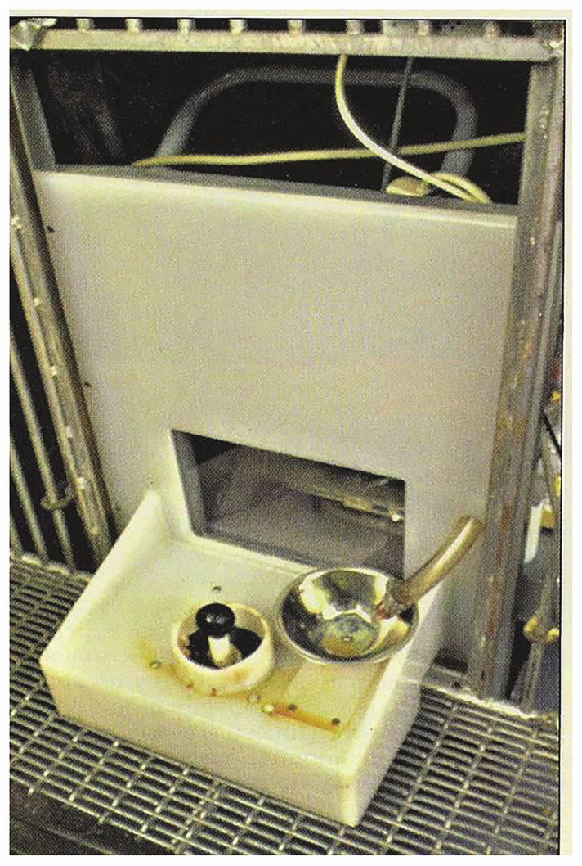
The interface must fit the animal’s vision and body
The joystick apparatus separated the monitor from the pig with a transparent window. A rounded knob supported snout contact rather than the hand grip used by primates. The device therefore translated an existing movement repertoire into a computer input.
The pigs were hyperopic, meaning that their eyes focused more readily on distant than nearby objects. Refraction measurements guided placement of the monitor approximately 45 cm from their eyes. Visual access was an experimentally adjusted property of the apparatus.
Cursor movement occurred at 8 cm/s on a 33 cm monitor. These dimensions determined how far a pig had to push the joystick and how quickly the visible outcome changed during a response.
Croney & Boysen (2021), Fig. 1. Joystick apparatus and monitor position.
Croney & Boysen (2021)
03
Notes:
• The joystick apparatus separated the monitor from the pig with a transparent window. A rounded knob supported snout contact rather than the hand grip used by primates. The device therefore translated an existing movement repertoire into a computer input.
• The pigs were hyperopic, meaning that their eyes focused more readily on distant than nearby objects. Refraction measurements guided placement of the monitor approximately 45 cm from their eyes. Visual access was an experimentally adjusted property of the apparatus.
• Cursor movement occurred at 8 cm/s on a 33 cm monitor. These dimensions determined how far a pig had to push the joystick and how quickly the visible outcome changed during a response.
• The four-wall stage accepts contact with any border. Removing borders changes the need for initial direction selection, whereas shortening the remaining wall adds a precision requirement. The same food consequence can therefore shape different components of cursor control.
References:
Croney CC, Boysen ST (2021). Acquisition of a Joystick-Operated Video Task by Pigs (Sus scrofa). Frontiers in Psychology 12:631755. https://doi.org/10.3389/fpsyg.2021.631755
Figure: Croney & Boysen (2021), Fig. 1. Joystick apparatus and monitor position.
Figure source: https://doi.org/10.3389/fpsyg.2021.631755

Slide 4
Shaping builds the joystick response gradually
Shaping reinforces successive approximations to a desired behavior. The pigs first received food for approaching a mock joystick, then for manipulating it with their snouts. A spring-mounted knob allowed practice before cursor control was introduced.
After this preparation, reinforcement followed orientation toward the monitor. The instruction to watch the screen was paired with joystick manipulation, linking visual attention and motor action within the same trained sequence.
The mock-joystick stage lasted two weeks. Food delivery, verbal feedback and tactile contact accompanied successful responding during subsequent testing. The trained action was therefore supported by an explicit reinforcement history, including social responses from the handler.
Croney & Boysen (2021), Fig. 2. Pig using its snout to operate the joystick.
Croney & Boysen (2021)
04
Notes:
• Shaping reinforces successive approximations to a desired behavior. The pigs first received food for approaching a mock joystick, then for manipulating it with their snouts. A spring-mounted knob allowed practice before cursor control was introduced.
• After this preparation, reinforcement followed orientation toward the monitor. The instruction to watch the screen was paired with joystick manipulation, linking visual attention and motor action within the same trained sequence.
• The mock-joystick stage lasted two weeks. Food delivery, verbal feedback and tactile contact accompanied successful responding during subsequent testing. The trained action was therefore supported by an explicit reinforcement history, including social responses from the handler.
• The four-wall stage accepts contact with any border. Removing borders changes the need for initial direction selection, whereas shortening the remaining wall adds a precision requirement. The same food consequence can therefore shape different components of cursor control.
References:
Croney CC, Boysen ST (2021). Acquisition of a Joystick-Operated Video Task by Pigs (Sus scrofa). Frontiers in Psychology 12:631755. https://doi.org/10.3389/fpsyg.2021.631755
Figure: Croney & Boysen (2021), Fig. 2. Pig using its snout to operate the joystick.
Figure source: https://doi.org/10.3389/fpsyg.2021.631755

Slide 5
Fewer target walls require more selective movement
The SIDE task began with a cursor in the middle of a screen bordered by four target walls. Any completed outward movement could reach a wall. Removing walls progressively required selection of the direction that still contained a rewarded target.
With one wall present, only one of the four main initial directions was correct. Target location varied among the top, bottom, left and right of the screen, preventing one repeated direction from solving every trial.
The program adjusted difficulty according to response speed. Successful responding led to fewer or shorter walls; slower responding restored easier conditions. The task thus changed the precision required while retaining the same joystick-to-cursor mapping.
Croney & Boysen (2021), Fig. 1. Joystick apparatus and monitor position.
Croney & Boysen (2021)
05
Notes:
• The SIDE task began with a cursor in the middle of a screen bordered by four target walls. Any completed outward movement could reach a wall. Removing walls progressively required selection of the direction that still contained a rewarded target.
• With one wall present, only one of the four main initial directions was correct. Target location varied among the top, bottom, left and right of the screen, preventing one repeated direction from solving every trial.
• The program adjusted difficulty according to response speed. Successful responding led to fewer or shorter walls; slower responding restored easier conditions. The task thus changed the precision required while retaining the same joystick-to-cursor mapping.
• The four-wall stage accepts contact with any border. Removing borders changes the need for initial direction selection, whereas shortening the remaining wall adds a precision requirement. The same food consequence can therefore shape different components of cursor control.
References:
Croney CC, Boysen ST (2021). Acquisition of a Joystick-Operated Video Task by Pigs (Sus scrofa). Frontiers in Psychology 12:631755. https://doi.org/10.3389/fpsyg.2021.631755
Figure: Croney & Boysen (2021), Fig. 1. Joystick apparatus and monitor position.
Figure source: https://doi.org/10.3389/fpsyg.2021.631755

Slide 6
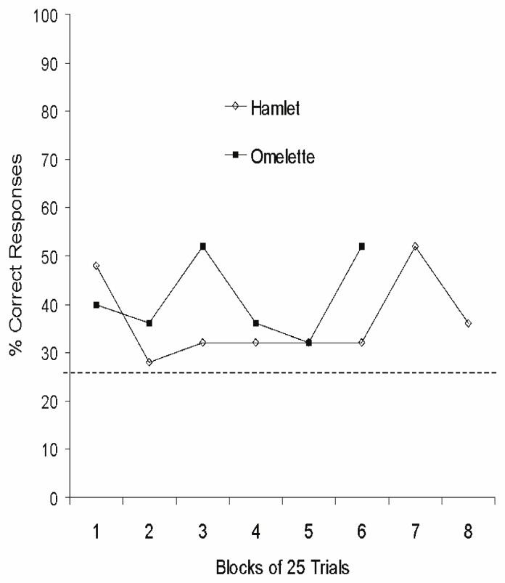
Initial cursor direction distinguishes target selection
Reaching some screen border after repeated movements is different from directing the cursor correctly on the first attempt. Croney and Boysen scored the first cursor movement to separate target selection from eventual contact after an extended search.
On the one-wall task, the Yorkshire pigs reached the correct target initially more often than random directional choices would predict. They also performed above random expectation when only two walls remained available.
Performance varied with target position. Vertical movements were generally easier for the Yorkshire pigs than horizontal movements. The position dependence linked the measured outcome to the physical demands of joystick manipulation as well as to learned visual selection.
Croney & Boysen (2021), Fig. 3. Yorkshire pigs selecting one-wall targets over training.
Croney & Boysen (2021)
06
Notes:
• Reaching some screen border after repeated movements is different from directing the cursor correctly on the first attempt. Croney and Boysen scored the first cursor movement to separate target selection from eventual contact after an extended search.
• On the one-wall task, the Yorkshire pigs reached the correct target initially more often than random directional choices would predict. They also performed above random expectation when only two walls remained available.
• Performance varied with target position. Vertical movements were generally easier for the Yorkshire pigs than horizontal movements. The position dependence linked the measured outcome to the physical demands of joystick manipulation as well as to learned visual selection.
• The four-wall stage accepts contact with any border. Removing borders changes the need for initial direction selection, whereas shortening the remaining wall adds a precision requirement. The same food consequence can therefore shape different components of cursor control.
References:
Croney CC, Boysen ST (2021). Acquisition of a Joystick-Operated Video Task by Pigs (Sus scrofa). Frontiers in Psychology 12:631755. https://doi.org/10.3389/fpsyg.2021.631755
Figure: Croney & Boysen (2021), Fig. 3. Yorkshire pigs selecting one-wall targets over training.
Figure source: https://doi.org/10.3389/fpsyg.2021.631755

Slide 7
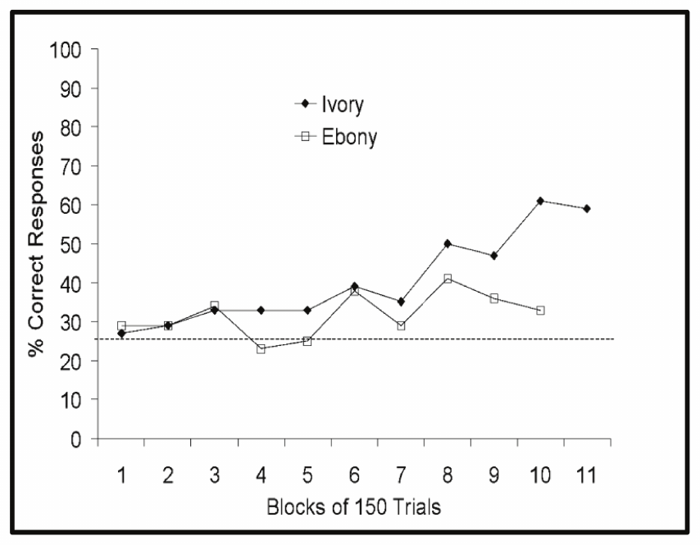
Individual pigs acquire different control strategies
The micro pigs differed markedly in one-wall performance. Ivory acquired effective responding across all target positions, whereas Ebony's strongest responding occurred toward selected locations. A single species-level description would conceal these distinct control patterns.
The micro pigs generally performed better in the horizontal plane, unlike the vertical advantage of the Yorkshire pigs. The animals therefore did not share one universal directional bias imposed by the task.
The training procedure was revised when easy trials dominated the micro pigs' sessions. Requiring exposure to two-wall and one-wall trials provided repeated experience with directional selection. Access to the more demanding contingencies was itself part of learning the task.
Croney & Boysen (2021), Fig. 4. Micro pigs selecting one-wall targets over training.
Croney & Boysen (2021)
07
Notes:
• The micro pigs differed markedly in one-wall performance. Ivory acquired effective responding across all target positions, whereas Ebony's strongest responding occurred toward selected locations. A single species-level description would conceal these distinct control patterns.
• The micro pigs generally performed better in the horizontal plane, unlike the vertical advantage of the Yorkshire pigs. The animals therefore did not share one universal directional bias imposed by the task.
• The training procedure was revised when easy trials dominated the micro pigs' sessions. Requiring exposure to two-wall and one-wall trials provided repeated experience with directional selection. Access to the more demanding contingencies was itself part of learning the task.
• The four-wall stage accepts contact with any border. Removing borders changes the need for initial direction selection, whereas shortening the remaining wall adds a precision requirement. The same food consequence can therefore shape different components of cursor control.
References:
Croney CC, Boysen ST (2021). Acquisition of a Joystick-Operated Video Task by Pigs (Sus scrofa). Frontiers in Psychology 12:631755. https://doi.org/10.3389/fpsyg.2021.631755
Figure: Croney & Boysen (2021), Fig. 4. Micro pigs selecting one-wall targets over training.
Figure source: https://doi.org/10.3389/fpsyg.2021.631755

Slide 8
Motor constraints can limit apparently cognitive tasks
A pig moving a joystick must orient the head, maintain visual access and apply force to a knob with its snout. These movements are mechanically different from a primate manipulating a joystick with its fingers.
The Yorkshire pigs eventually became too large for the apparatus. Growth changed the body's fit to the testing environment without changing the abstract rule that cursor contact produced a reward. The animals' ability to participate depended on the physical interface.
Croney and Boysen proposed touchscreen testing as an alternative for pigs. Direct contact with a displayed target can reduce the indirect movement demands of joystick control while retaining computerized stimulus presentation and response recording.
Croney & Boysen (2021), Fig. 2. Pig using its snout to operate the joystick.
Croney & Boysen (2021)
08
Notes:
• A pig moving a joystick must orient the head, maintain visual access and apply force to a knob with its snout. These movements are mechanically different from a primate manipulating a joystick with its fingers.
• The Yorkshire pigs eventually became too large for the apparatus. Growth changed the body's fit to the testing environment without changing the abstract rule that cursor contact produced a reward. The animals' ability to participate depended on the physical interface.
• Croney and Boysen proposed touchscreen testing as an alternative for pigs. Direct contact with a displayed target can reduce the indirect movement demands of joystick control while retaining computerized stimulus presentation and response recording.
• The four-wall stage accepts contact with any border. Removing borders changes the need for initial direction selection, whereas shortening the remaining wall adds a precision requirement. The same food consequence can therefore shape different components of cursor control.
References:
Croney CC, Boysen ST (2021). Acquisition of a Joystick-Operated Video Task by Pigs (Sus scrofa). Frontiers in Psychology 12:631755. https://doi.org/10.3389/fpsyg.2021.631755
Figure: Croney & Boysen (2021), Fig. 2. Pig using its snout to operate the joystick.
Figure source: https://doi.org/10.3389/fpsyg.2021.631755

Slide 9
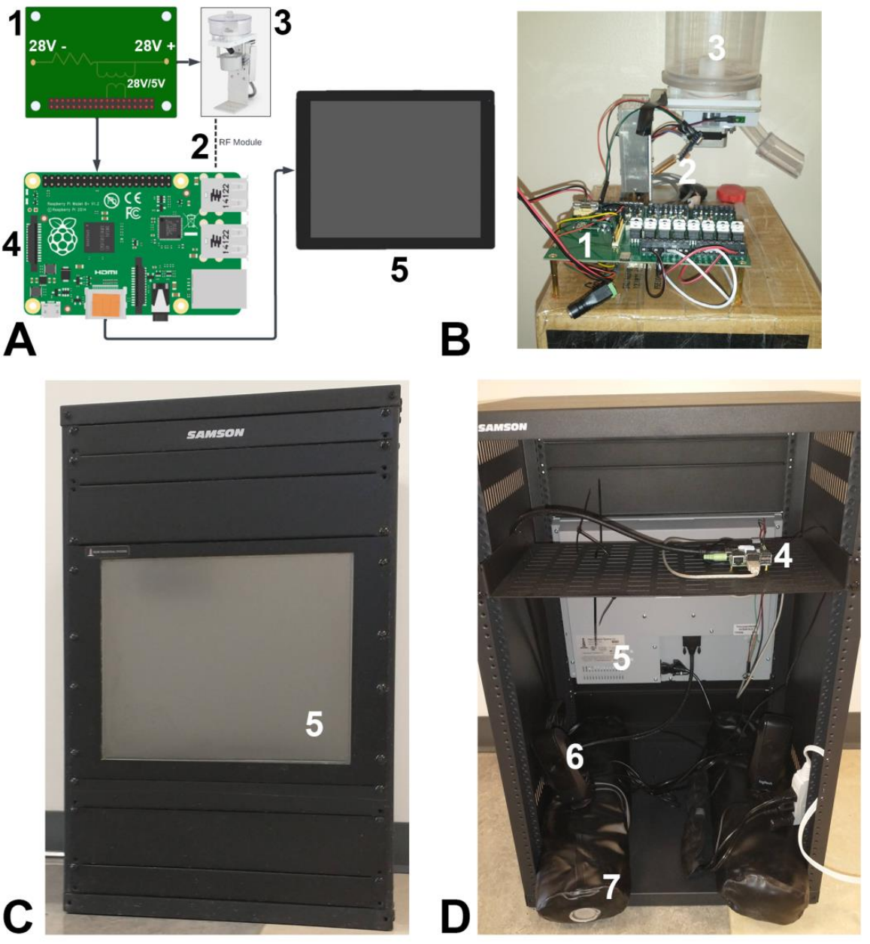
Touchscreens translate nose contact into recorded choices
Ao and colleagues built a touchscreen system for pigs in which a nose press registered a response to a displayed button. A computer logged each response and controlled auditory feedback and food delivery.
The completed apparatus used an industrial resistive screen in a weighted rack. Resistive sensing detected pressure on the screen, allowing contact by the pig's snout to operate the device. The rack could be adjusted for animals of different heights.
Food was delivered away from the screen through a separately controlled dispenser. Separating the response surface from food reduced rooting toward the monitor while preserving the relationship between a successful screen response and its consequence.
Ao et al. (2022), Fig. 1. Device components and completed pig touchscreen.
Ao et al. (2022)
09
Notes:
• Ao and colleagues built a touchscreen system for pigs in which a nose press registered a response to a displayed button. A computer logged each response and controlled auditory feedback and food delivery.
• The completed apparatus used an industrial resistive screen in a weighted rack. Resistive sensing detected pressure on the screen, allowing contact by the pig's snout to operate the device. The rack could be adjusted for animals of different heights.
• Food was delivered away from the screen through a separately controlled dispenser. Separating the response surface from food reduced rooting toward the monitor while preserving the relationship between a successful screen response and its consequence.
• The pigs approached the monitor with their snouts and sometimes continued contact as an upward swipe. Registering a press rather than its release changed which moment of that movement counted as the recorded response. Immediate tones also distinguished an accepted contact from an unregistered movement.
References:
Ao W, Grace M, Floyd CL, Vonder Haar C (2022). A Touchscreen Device for Behavioral Testing in Pigs. Biomedicines 10:2612. https://doi.org/10.3390/biomedicines10102612
Figure: Ao et al. (2022), Fig. 1. Device components and completed pig touchscreen.
Figure source: https://doi.org/10.3390/biomedicines10102612

Slide 10
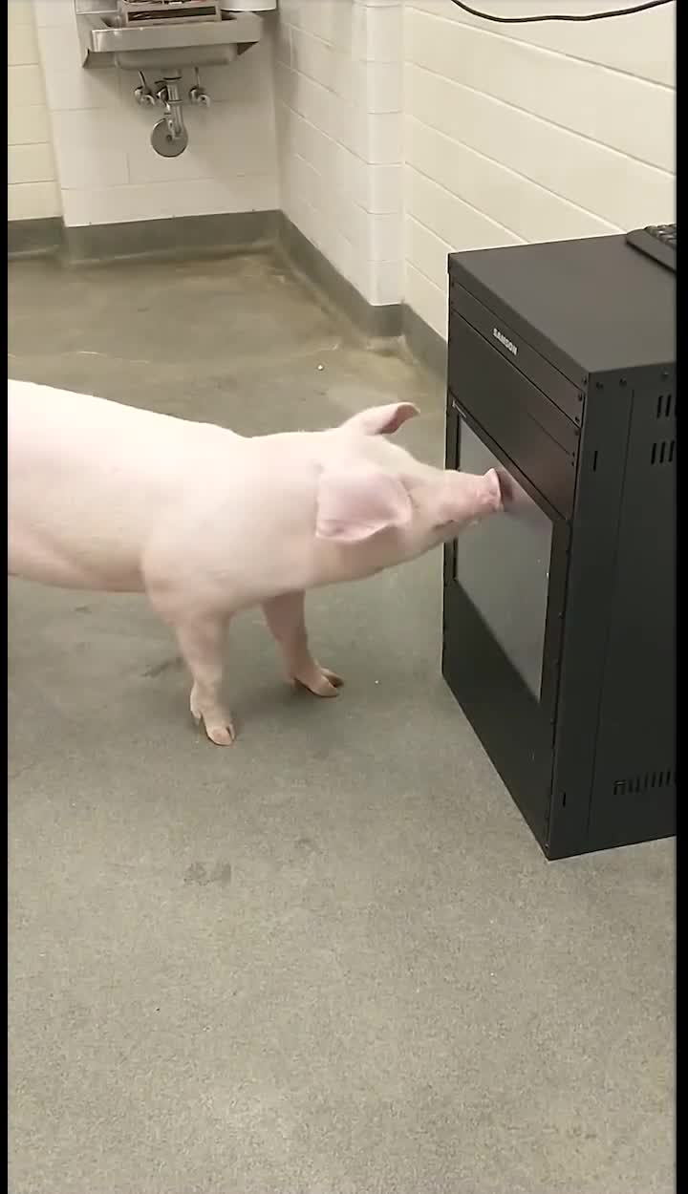
A nose swipe changes where software registers a choice
Pigs often pressed a target and then swiped upward at a slight diagonal. When software registered the release of contact, the recorded response could occur above the button that the pig initially touched.
Ao and colleagues changed the buttons to respond on initial touch. This altered the event that counted as a choice while leaving the animal's contact movement largely intact. A software convention could otherwise turn an accurate initial press into an apparent error.
Tones identified a registered response and the beginning of a trial. Auditory feedback supplied an immediate consequence when the screen itself provided little tactile confirmation that the computer had accepted the movement.
Ao et al. (2022), Fig. 1. Device components and completed pig touchscreen.
Ao et al. (2022), Supplementary Video S2. Touchscreen response shaping.
Ao et al. (2022)
10
Notes:
• Pigs often pressed a target and then swiped upward at a slight diagonal. When software registered the release of contact, the recorded response could occur above the button that the pig initially touched.
• Ao and colleagues changed the buttons to respond on initial touch. This altered the event that counted as a choice while leaving the animal's contact movement largely intact. A software convention could otherwise turn an accurate initial press into an apparent error.
• Tones identified a registered response and the beginning of a trial. Auditory feedback supplied an immediate consequence when the screen itself provided little tactile confirmation that the computer had accepted the movement.
• The pigs approached the monitor with their snouts and sometimes continued contact as an upward swipe. Registering a press rather than its release changed which moment of that movement counted as the recorded response. Immediate tones also distinguished an accepted contact from an unregistered movement.
References:
Ao W, Grace M, Floyd CL, Vonder Haar C (2022). A Touchscreen Device for Behavioral Testing in Pigs. Biomedicines 10:2612. https://doi.org/10.3390/biomedicines10102612
Figure: Ao et al. (2022), Fig. 1. Device components and completed pig touchscreen.
Figure source: https://doi.org/10.3390/biomedicines10102612
Article-provided recording:
Ao et al. (2022), Supplementary Video S2. Touchscreen response shaping.
The original study recording retains its original sequence, audio, timing and source annotations. Click during PowerPoint Slide Show for full-screen playback. Its poster is an unedited frame. Google Slides imports can omit embedded video; upload the supplied MP4 to Drive and insert it as a video. PowerPoint GUI playback was unavailable for testing.
DOI: https://doi.org/10.3390/biomedicines10102612
Original media: https://mdpi-res.com/d_attachment/biomedicines/biomedicines-10-02612/article_deploy/biomedicines-10-02612-s001.zip
Credit: original study authors and publisher.
License: CC BY 4.0, article supplementary material

Slide 11
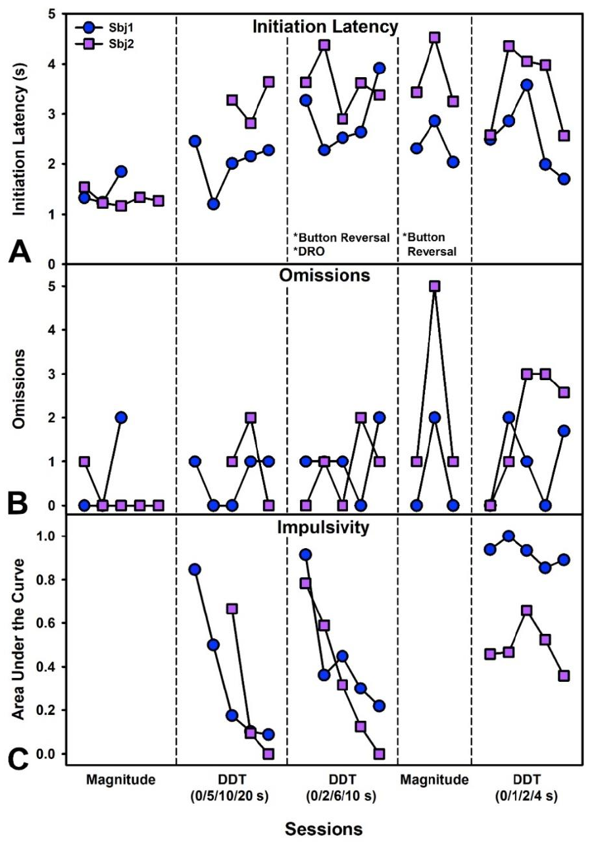
Delayed rewards change touchscreen choice
Delay discounting is a reduction in the value assigned to a reward when obtaining it requires waiting. The pigs chose between a button delivering one pellet and a button delivering four pellets.
When both outcomes were immediate, training established preference for the larger reward. The experiment then introduced delays before the four-pellet outcome while leaving the smaller outcome available sooner. Reward magnitude and waiting time were manipulated separately.
Pigs rapidly avoided delayed reinforcement. Adjustments to button locations and delay schedules were used during device testing, and later choice remained sensitive to the introduced delay. The touchscreen made the temporal cost of an action part of its learned consequence.
Ao et al. (2022), Fig. 2. Choices and response latencies during delay discounting.
Ao et al. (2022)
11
Notes:
• Delay discounting is a reduction in the value assigned to a reward when obtaining it requires waiting. The pigs chose between a button delivering one pellet and a button delivering four pellets.
• When both outcomes were immediate, training established preference for the larger reward. The experiment then introduced delays before the four-pellet outcome while leaving the smaller outcome available sooner. Reward magnitude and waiting time were manipulated separately.
• Pigs rapidly avoided delayed reinforcement. Adjustments to button locations and delay schedules were used during device testing, and later choice remained sensitive to the introduced delay. The touchscreen made the temporal cost of an action part of its learned consequence.
• The pigs approached the monitor with their snouts and sometimes continued contact as an upward swipe. Registering a press rather than its release changed which moment of that movement counted as the recorded response. Immediate tones also distinguished an accepted contact from an unregistered movement.
References:
Ao W, Grace M, Floyd CL, Vonder Haar C (2022). A Touchscreen Device for Behavioral Testing in Pigs. Biomedicines 10:2612. https://doi.org/10.3390/biomedicines10102612
Figure: Ao et al. (2022), Fig. 2. Choices and response latencies during delay discounting.
Figure source: https://doi.org/10.3390/biomedicines10102612

Slide 12
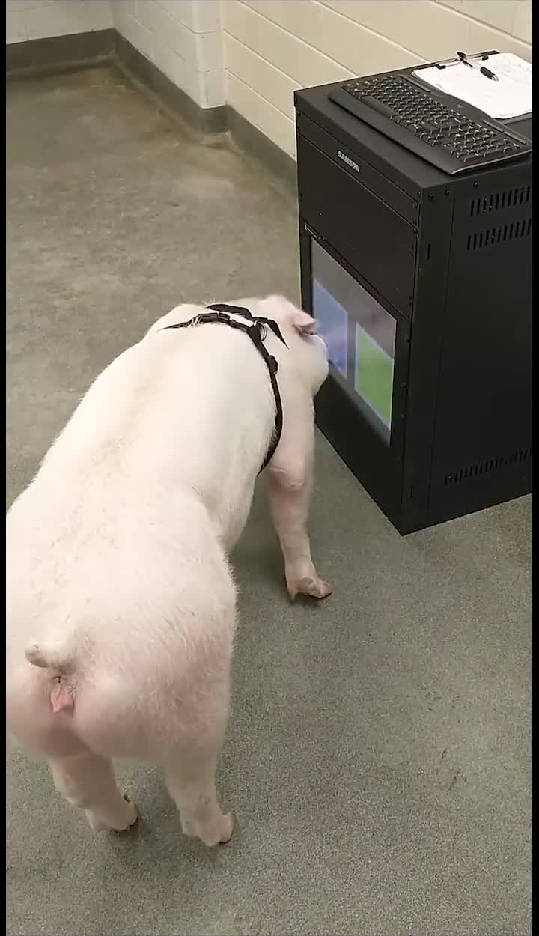
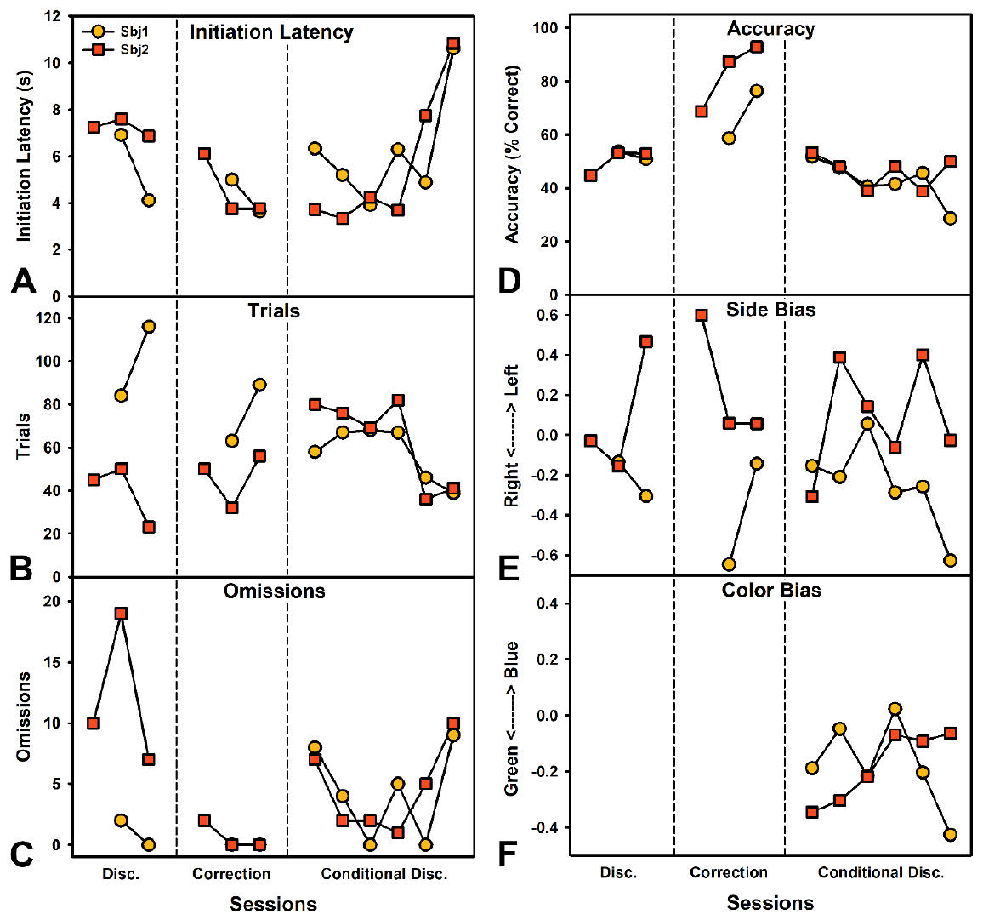
Correction trials support color discrimination
In the initial color task, choosing the yellow button produced food while the blue button did not. The locations of the buttons varied, so successful responding required using color rather than always touching the same side.
Accuracy was initially low. A correction trial repeated an incorrectly answered problem while making the incorrect option inactive. After this change, accurate color selection increased rapidly over one or two sessions.
The subsequent conditional task required the pig to select the color matching a preceding central stimulus. Accuracy declined when this additional relation was introduced. Learning one rewarded color was therefore behaviorally different from selecting a color according to a changing sample.
Ao et al. (2022), Fig. 3. Accuracy and biases during color discrimination.
Ao et al. (2022), Supplementary Video S3. Pig color discrimination.
Ao et al. (2022)
12
Notes:
• In the initial color task, choosing the yellow button produced food while the blue button did not. The locations of the buttons varied, so successful responding required using color rather than always touching the same side.
• Accuracy was initially low. A correction trial repeated an incorrectly answered problem while making the incorrect option inactive. After this change, accurate color selection increased rapidly over one or two sessions.
• The subsequent conditional task required the pig to select the color matching a preceding central stimulus. Accuracy declined when this additional relation was introduced. Learning one rewarded color was therefore behaviorally different from selecting a color according to a changing sample.
• The pigs approached the monitor with their snouts and sometimes continued contact as an upward swipe. Registering a press rather than its release changed which moment of that movement counted as the recorded response. Immediate tones also distinguished an accepted contact from an unregistered movement.
References:
Ao W, Grace M, Floyd CL, Vonder Haar C (2022). A Touchscreen Device for Behavioral Testing in Pigs. Biomedicines 10:2612. https://doi.org/10.3390/biomedicines10102612
Figure: Ao et al. (2022), Fig. 3. Accuracy and biases during color discrimination.
Figure source: https://doi.org/10.3390/biomedicines10102612
Article-provided recording:
Ao et al. (2022), Supplementary Video S3. Pig color discrimination.
The original study recording retains its original sequence, audio, timing and source annotations. Click during PowerPoint Slide Show for full-screen playback. Its poster is an unedited frame. Google Slides imports can omit embedded video; upload the supplied MP4 to Drive and insert it as a video. PowerPoint GUI playback was unavailable for testing.
DOI: https://doi.org/10.3390/biomedicines10102612
Original media: https://mdpi-res.com/d_attachment/biomedicines/biomedicines-10-02612/article_deploy/biomedicines-10-02612-s001.zip
Credit: original study authors and publisher.
License: CC BY 4.0, article supplementary material

Slide 13
Response demands shape participation as well as accuracy
The touchscreen pigs explored their surroundings during testing, sometimes leaving the device during a trial. A tone signaling trial onset helped reorient them toward the screen. The testing room contained competing opportunities for action.
Increasing the required number of presses made the color task more demanding. The added response requirement did not restore accurate conditional matching, and withholding expected food could interrupt re-engagement with the screen.
Device durability also changed participation. The first screen broke during repeated testing, whereas the revised industrial version remained intact. Recorded performance emerged from an interaction among learned task rules, response demands, reinforcement delivery and an apparatus able to withstand the animal's movements.
Ao et al. (2022), Fig. 3. Accuracy and biases during color discrimination.
Ao et al. (2022)
13
Notes:
• The touchscreen pigs explored their surroundings during testing, sometimes leaving the device during a trial. A tone signaling trial onset helped reorient them toward the screen. The testing room contained competing opportunities for action.
• Increasing the required number of presses made the color task more demanding. The added response requirement did not restore accurate conditional matching, and withholding expected food could interrupt re-engagement with the screen.
• Device durability also changed participation. The first screen broke during repeated testing, whereas the revised industrial version remained intact. Recorded performance emerged from an interaction among learned task rules, response demands, reinforcement delivery and an apparatus able to withstand the animal's movements.
• The pigs approached the monitor with their snouts and sometimes continued contact as an upward swipe. Registering a press rather than its release changed which moment of that movement counted as the recorded response. Immediate tones also distinguished an accepted contact from an unregistered movement.
References:
Ao W, Grace M, Floyd CL, Vonder Haar C (2022). A Touchscreen Device for Behavioral Testing in Pigs. Biomedicines 10:2612. https://doi.org/10.3390/biomedicines10102612
Figure: Ao et al. (2022), Fig. 3. Accuracy and biases during color discrimination.
Figure source: https://doi.org/10.3390/biomedicines10102612

Slide 14
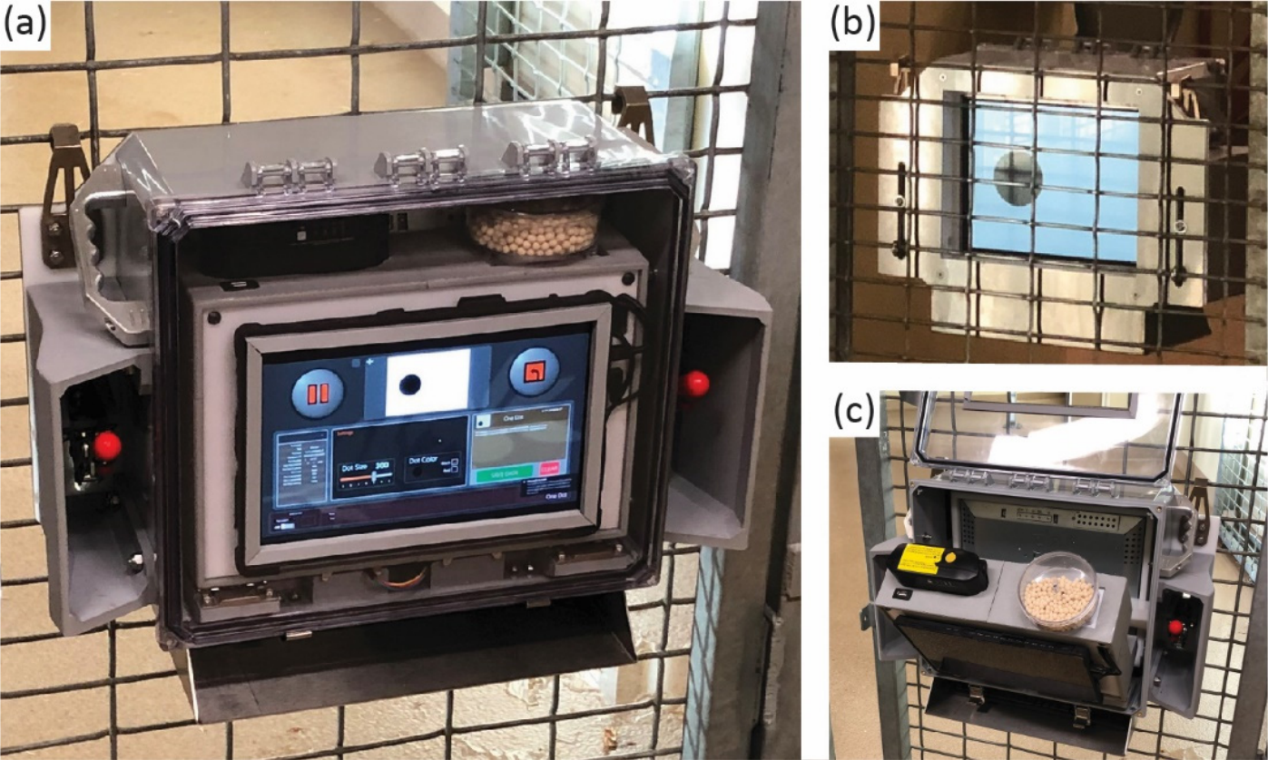
Portable touchscreens bring tasks into social enclosures
Martin and colleagues developed Apex, a battery-powered touchscreen mounted on the mesh of a primate enclosure. An animal-facing screen presented stimuli, while a separate interface allowed the experimenter to control the task.
The device included food delivery, sound and colored light feedback. Responses could be tested where the macaques already lived, avoiding a requirement to transport each animal into a separate testing chamber for every session.
ApeTouch software provided training, preference and discrimination tasks through the same apparatus. The physical device remained stable while the stimulus arrangement and response rule changed. Computerized testing thus separated the animal's access to an interface from the particular problem presented on it.
Martin et al. (2022), Fig. 1. Portable touchscreen mounted on enclosure mesh.
Martin et al. (2022)
14
Notes:
• Martin and colleagues developed Apex, a battery-powered touchscreen mounted on the mesh of a primate enclosure. An animal-facing screen presented stimuli, while a separate interface allowed the experimenter to control the task.
• The device included food delivery, sound and colored light feedback. Responses could be tested where the macaques already lived, avoiding a requirement to transport each animal into a separate testing chamber for every session.
• ApeTouch software provided training, preference and discrimination tasks through the same apparatus. The physical device remained stable while the stimulus arrangement and response rule changed. Computerized testing thus separated the animal's access to an interface from the particular problem presented on it.
• The macaques worked in 10-minute sessions with the touchscreen mounted on enclosure mesh. The numbered task retained random spatial locations while requiring 1 before 2. A monkey could not solve that changing arrangement by repeating the same left-to-right sequence on every trial.
References:
Martin CF, Muramatsu A, Matsuzawa T (2022). Apex and ApeTouch: Development of a Portable Touchscreen System and Software for Primates at Zoos. Animals 12:1660. https://doi.org/10.3390/ani12131660
Figure: Martin et al. (2022), Fig. 1. Portable touchscreen mounted on enclosure mesh.
Figure source: https://doi.org/10.3390/ani12131660

Slide 15
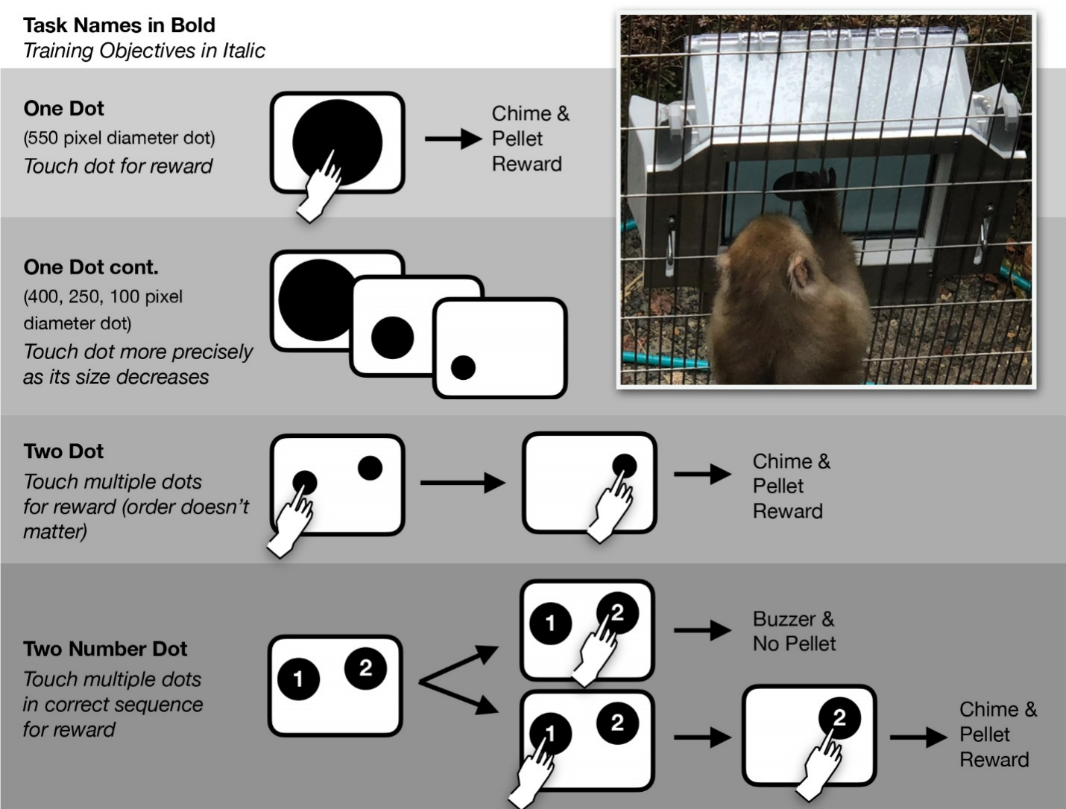
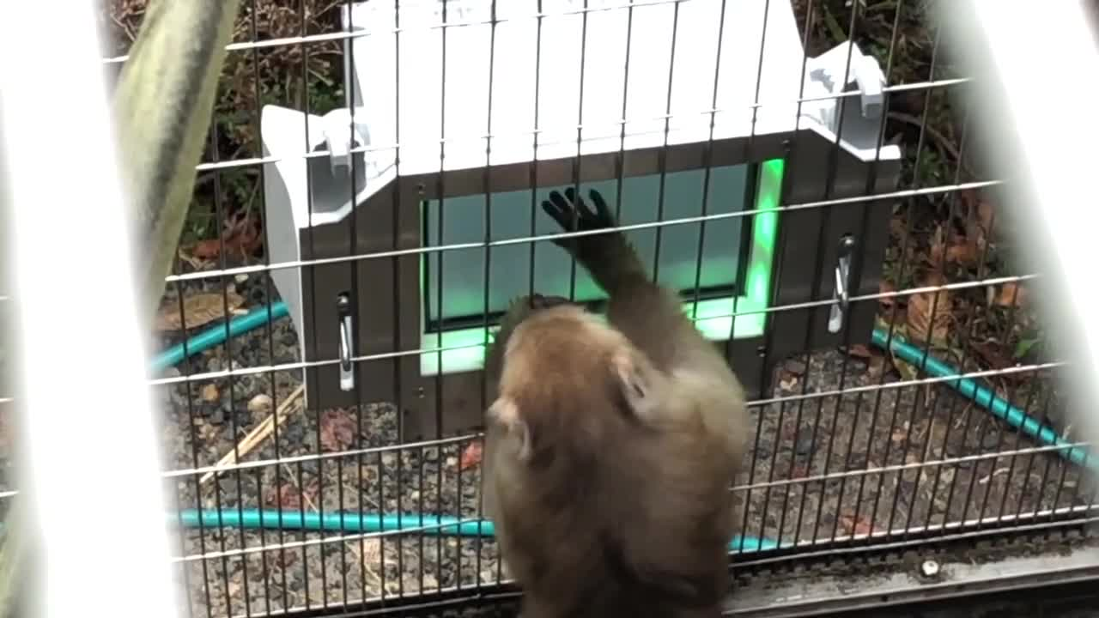
Smaller dots train more precise screen contact
The first Apex training task presented one black dot at a random screen location. Touching it removed the dot and produced a chime, light feedback and a food pellet. Each trial linked a specific visual target to a direct hand movement.
The dot initially occupied much of the screen. Its diameter was reduced from 550 to 100 pixels over training, progressively increasing the precision required to contact the stimulus.
Randomized target position made the macaques follow the dot across the screen rather than repeat a single movement. The consequence remained consistent as target size changed, allowing the same basic response to become spatially more selective.
Martin et al. (2022), Fig. 3. Touchscreen training tasks and a macaque at the device.
Martin et al. (2022), Supplementary Video S1. Macaque touchscreen tasks.
Martin et al. (2022)
15
Notes:
• The first Apex training task presented one black dot at a random screen location. Touching it removed the dot and produced a chime, light feedback and a food pellet. Each trial linked a specific visual target to a direct hand movement.
• The dot initially occupied much of the screen. Its diameter was reduced from 550 to 100 pixels over training, progressively increasing the precision required to contact the stimulus.
• Randomized target position made the macaques follow the dot across the screen rather than repeat a single movement. The consequence remained consistent as target size changed, allowing the same basic response to become spatially more selective.
• The macaques worked in 10-minute sessions with the touchscreen mounted on enclosure mesh. The numbered task retained random spatial locations while requiring 1 before 2. A monkey could not solve that changing arrangement by repeating the same left-to-right sequence on every trial.
References:
Martin CF, Muramatsu A, Matsuzawa T (2022). Apex and ApeTouch: Development of a Portable Touchscreen System and Software for Primates at Zoos. Animals 12:1660. https://doi.org/10.3390/ani12131660
Figure: Martin et al. (2022), Fig. 3. Touchscreen training tasks and a macaque at the device.
Figure source: https://doi.org/10.3390/ani12131660
Article-provided recording:
Martin et al. (2022), Supplementary Video S1. Macaque touchscreen tasks.
The original study recording retains its original sequence, audio, timing and source annotations. Click during PowerPoint Slide Show for full-screen playback. Its poster is an unedited frame. Google Slides imports can omit embedded video; upload the supplied MP4 to Drive and insert it as a video. PowerPoint GUI playback was unavailable for testing.
DOI: https://doi.org/10.3390/ani12131660
Original media: https://mdpi-res.com/d_attachment/animals/animals-12-01660/article_deploy/animals-12-01660-s001.zip
Credit: original study authors and publisher.
License: CC BY 4.0, article supplementary material

Slide 16
Touching two targets introduces a response sequence
The Two Dot task presented two targets simultaneously. Touching either target removed it, but food arrived only after both had been contacted. A first successful movement therefore left a second required movement unfinished.
The Two Number Dot task added numerals to the same basic arrangement. Touching the dot labeled 1 before the dot labeled 2 produced reinforcement; beginning with 2 produced an error signal and no food.
The rule required a learned order of contact rather than simply two screen touches. Random target positions prevented a fixed spatial sequence from solving the task, linking the order of movements to the visible numerals.
Martin et al. (2022), Fig. 3. Touchscreen training tasks and a macaque at the device.
Martin et al. (2022)
16
Notes:
• The Two Dot task presented two targets simultaneously. Touching either target removed it, but food arrived only after both had been contacted. A first successful movement therefore left a second required movement unfinished.
• The Two Number Dot task added numerals to the same basic arrangement. Touching the dot labeled 1 before the dot labeled 2 produced reinforcement; beginning with 2 produced an error signal and no food.
• The rule required a learned order of contact rather than simply two screen touches. Random target positions prevented a fixed spatial sequence from solving the task, linking the order of movements to the visible numerals.
• The macaques worked in 10-minute sessions with the touchscreen mounted on enclosure mesh. The numbered task retained random spatial locations while requiring 1 before 2. A monkey could not solve that changing arrangement by repeating the same left-to-right sequence on every trial.
References:
Martin CF, Muramatsu A, Matsuzawa T (2022). Apex and ApeTouch: Development of a Portable Touchscreen System and Software for Primates at Zoos. Animals 12:1660. https://doi.org/10.3390/ani12131660
Figure: Martin et al. (2022), Fig. 3. Touchscreen training tasks and a macaque at the device.
Figure source: https://doi.org/10.3390/ani12131660

Slide 17
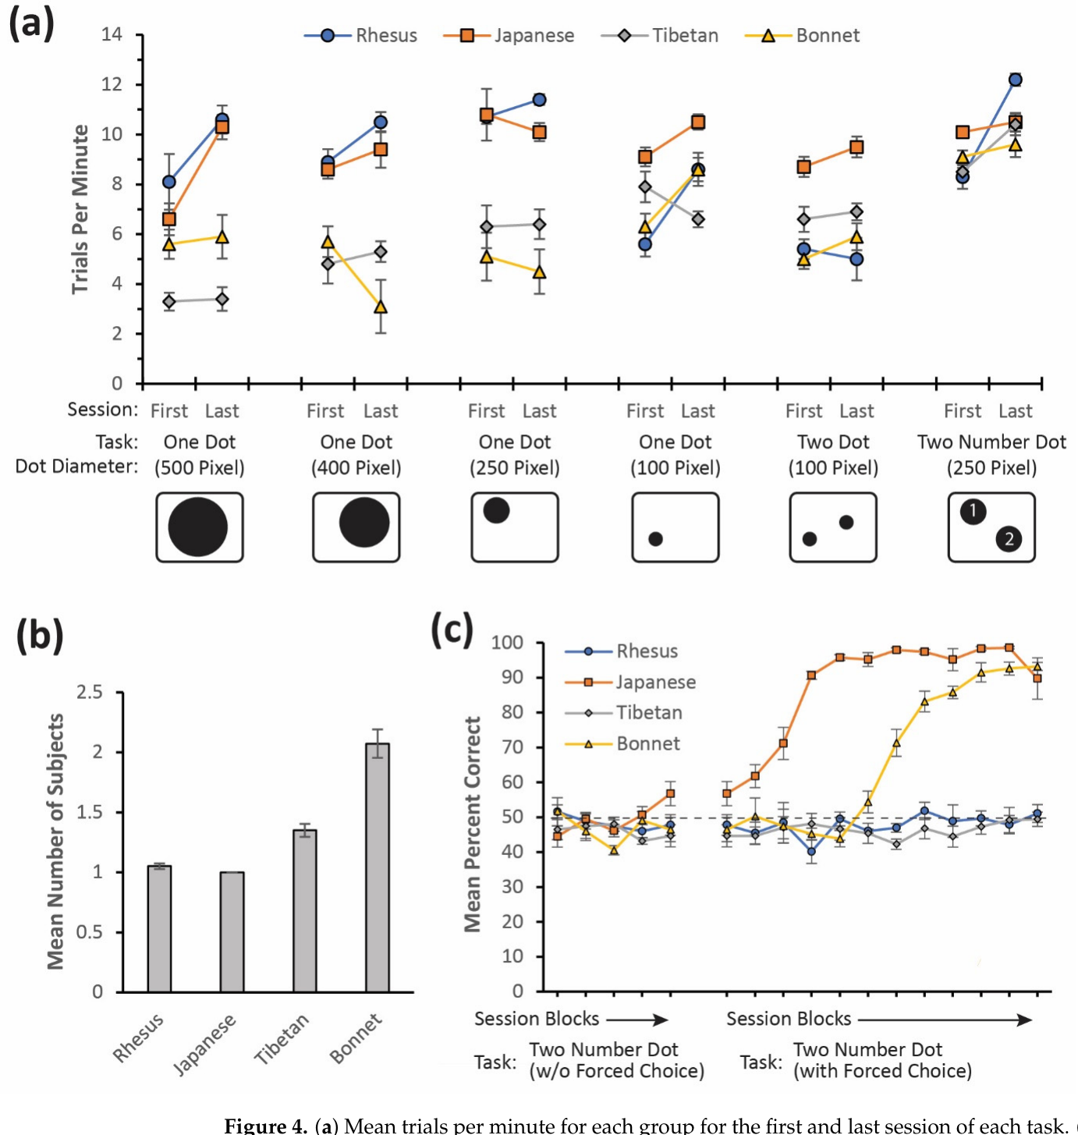
Social rank changes who gets access to the interface
The touchscreen was available to macaques living in groups. In the rhesus and Japanese groups, a dominant individual monopolized the device. In the Tibetan and bonnet groups, several individuals commonly shared access.
A group-level record of screen responses therefore did not mean that all members had equal experience. Competition for the device changed who could practice the visual and motor contingencies during the testing period.
Usage generally increased across training. Access patterns were recorded alongside trial completion, allowing engagement with the task to be separated from the distribution of opportunities within the social group. An enclosure-based interface became part of the group's social environment.
Martin et al. (2022), Fig. 4. Engagement, device access and sequencing performance.
Martin et al. (2022)
17
Notes:
• The touchscreen was available to macaques living in groups. In the rhesus and Japanese groups, a dominant individual monopolized the device. In the Tibetan and bonnet groups, several individuals commonly shared access.
• A group-level record of screen responses therefore did not mean that all members had equal experience. Competition for the device changed who could practice the visual and motor contingencies during the testing period.
• Usage generally increased across training. Access patterns were recorded alongside trial completion, allowing engagement with the task to be separated from the distribution of opportunities within the social group. An enclosure-based interface became part of the group's social environment.
• The macaques worked in 10-minute sessions with the touchscreen mounted on enclosure mesh. The numbered task retained random spatial locations while requiring 1 before 2. A monkey could not solve that changing arrangement by repeating the same left-to-right sequence on every trial.
References:
Martin CF, Muramatsu A, Matsuzawa T (2022). Apex and ApeTouch: Development of a Portable Touchscreen System and Software for Primates at Zoos. Animals 12:1660. https://doi.org/10.3390/ani12131660
Figure: Martin et al. (2022), Fig. 4. Engagement, device access and sequencing performance.
Figure source: https://doi.org/10.3390/ani12131660

Slide 18
Practice and forced trials change sequencing performance
Japanese and bonnet macaques acquired above-random performance on the Two Number Dot task and maintained it during subsequent testing. The rhesus and Tibetan groups did not reach that level within the study period.
For later sessions, some trials presented only the dot labeled 1. These forced trials guaranteed practice with the correct first response before the two-target problem returned. They changed the training history without changing the rewarded order.
Forced trials were excluded when performance on the two-choice task was evaluated. This retained the distinction between producing a required movement when no alternative was available and selecting the correct first movement when both numbered targets appeared.
Martin et al. (2022), Fig. 4. Engagement, device access and sequencing performance.
Martin et al. (2022)
18
Notes:
• Japanese and bonnet macaques acquired above-random performance on the Two Number Dot task and maintained it during subsequent testing. The rhesus and Tibetan groups did not reach that level within the study period.
• For later sessions, some trials presented only the dot labeled 1. These forced trials guaranteed practice with the correct first response before the two-target problem returned. They changed the training history without changing the rewarded order.
• Forced trials were excluded when performance on the two-choice task was evaluated. This retained the distinction between producing a required movement when no alternative was available and selecting the correct first movement when both numbered targets appeared.
• The macaques worked in 10-minute sessions with the touchscreen mounted on enclosure mesh. The numbered task retained random spatial locations while requiring 1 before 2. A monkey could not solve that changing arrangement by repeating the same left-to-right sequence on every trial.
References:
Martin CF, Muramatsu A, Matsuzawa T (2022). Apex and ApeTouch: Development of a Portable Touchscreen System and Software for Primates at Zoos. Animals 12:1660. https://doi.org/10.3390/ani12131660
Figure: Martin et al. (2022), Fig. 4. Engagement, device access and sequencing performance.
Figure source: https://doi.org/10.3390/ani12131660

Slide 19
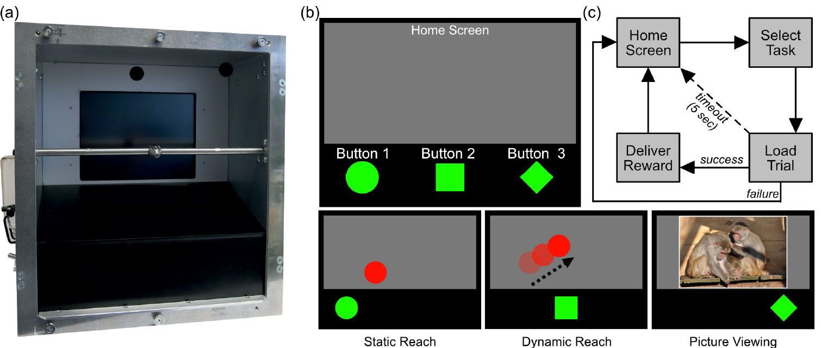
Macaques choose which touchscreen task to perform
Calapai and colleagues offered rhesus macaques a multiple-choice interface with three task buttons. An animal could select a stationary-target task, a moving-target task or picture viewing at the start of a trial.
The reaching tasks delivered diluted juice after a correct touch. Picture viewing delivered neither fluid reward nor an additional response requirement. The animals could therefore choose between different forms of engagement with the same screen.
The interface operated in their living environment without social separation or fluid restriction for this study. Each button selection opened a particular set of sensory and response consequences, making task selection itself an observable behavior.
Calapai et al. (2023), Fig. 1. Multiple-choice interface and reward delivery.
Calapai et al. (2023)
19
Notes:
• Calapai and colleagues offered rhesus macaques a multiple-choice interface with three task buttons. An animal could select a stationary-target task, a moving-target task or picture viewing at the start of a trial.
• The reaching tasks delivered diluted juice after a correct touch. Picture viewing delivered neither fluid reward nor an additional response requirement. The animals could therefore choose between different forms of engagement with the same screen.
• The interface operated in their living environment without social separation or fluid restriction for this study. Each button selection opened a particular set of sensory and response consequences, making task selection itself an observable behavior.
• The static and dynamic tasks delivered 0.37 mL of diluted juice after a correct touch. A failure produced different auditory feedback and no fluid. A trial without a response within 5 seconds ended without reward, after which the animal could select a task again.
References:
Calapai A, Pfefferle D, Cassidy LC, Nazari A, Yurt P, Brockhausen RR, Treue S (2023). A Touchscreen-Based, Multiple-Choice Approach to Cognitive Enrichment of Captive Rhesus Macaques (Macaca mulatta). Animals 13:2702. https://doi.org/10.3390/ani13172702
Figure: Calapai et al. (2023), Fig. 1. Multiple-choice interface and reward delivery.
Figure source: https://doi.org/10.3390/ani13172702

Slide 20
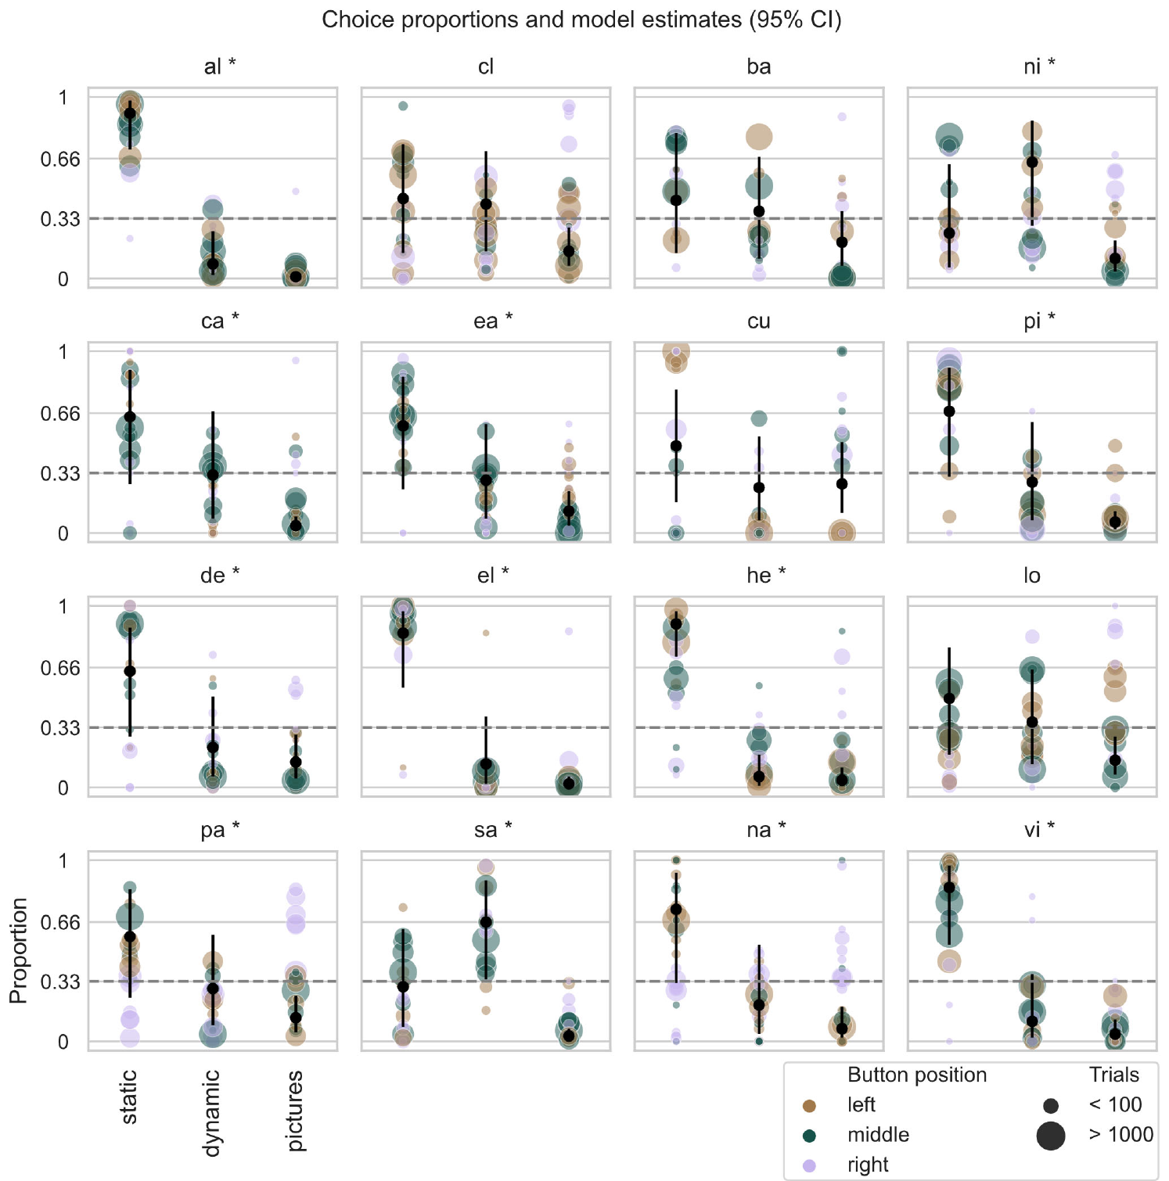
Task preferences persist across button locations
A monkey that repeatedly touches one side of a screen may appear to prefer a task simply because its button is located there. The multiple-choice study changed button arrangements to separate spatial bias from task selection.
Most animals with consistent task preferences favored the stationary-target task; others favored the moving-target task. The preference analysis considered button position as well as repeated selections across time and sessions.
The distinction between preferred task and preferred location depended on presenting the same task through different spatial arrangements. The animal's choices could then be related to task consequences rather than attributed automatically to the shape or side of a button.
Calapai et al. (2023), Fig. 3. Task preferences across button positions.
Calapai et al. (2023)
20
Notes:
• A monkey that repeatedly touches one side of a screen may appear to prefer a task simply because its button is located there. The multiple-choice study changed button arrangements to separate spatial bias from task selection.
• Most animals with consistent task preferences favored the stationary-target task; others favored the moving-target task. The preference analysis considered button position as well as repeated selections across time and sessions.
• The distinction between preferred task and preferred location depended on presenting the same task through different spatial arrangements. The animal's choices could then be related to task consequences rather than attributed automatically to the shape or side of a button.
• The static and dynamic tasks delivered 0.37 mL of diluted juice after a correct touch. A failure produced different auditory feedback and no fluid. A trial without a response within 5 seconds ended without reward, after which the animal could select a task again.
References:
Calapai A, Pfefferle D, Cassidy LC, Nazari A, Yurt P, Brockhausen RR, Treue S (2023). A Touchscreen-Based, Multiple-Choice Approach to Cognitive Enrichment of Captive Rhesus Macaques (Macaca mulatta). Animals 13:2702. https://doi.org/10.3390/ani13172702
Figure: Calapai et al. (2023), Fig. 3. Task preferences across button positions.
Figure source: https://doi.org/10.3390/ani13172702

Slide 21
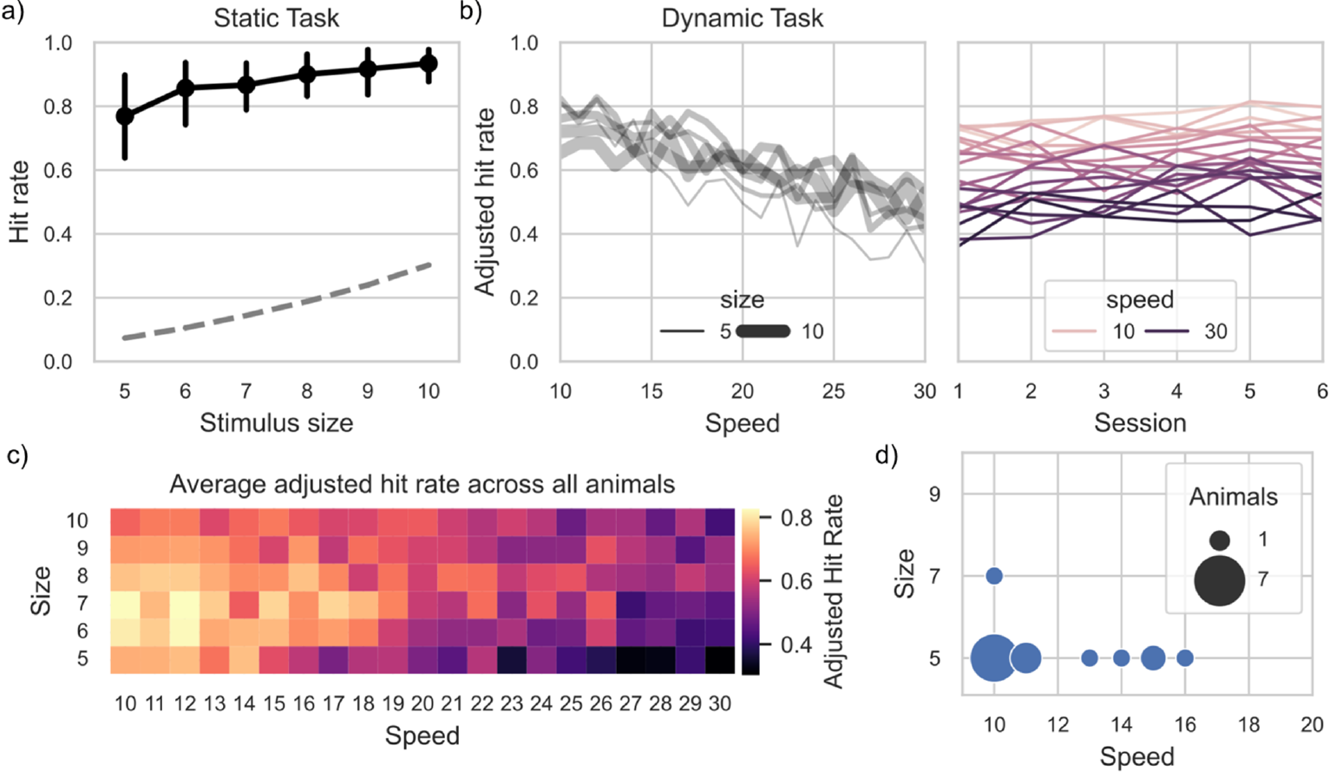
Moving targets couple touch timing to visual motion
The stationary reach task required touching a red target at its displayed location. In the dynamic task, the target moved and bounced around the screen until the trial ended. A hand movement had to reach where the target was at contact.
Target speeds ranged from 10 to 30 degrees of visual angle per second. Visual angle describes the angular size or displacement of a stimulus at the eye, allowing stimulus geometry to be expressed relative to viewing position.
Accuracy depended on combinations of speed and target size. Small targets moving slowly produced particularly effective responding after accounting for their screen area. Spatial precision and movement timing jointly shaped performance.
Calapai et al. (2023), Fig. 4. Touch accuracy across target sizes and speeds.
Calapai et al. (2023)
21
Notes:
• The stationary reach task required touching a red target at its displayed location. In the dynamic task, the target moved and bounced around the screen until the trial ended. A hand movement had to reach where the target was at contact.
• Target speeds ranged from 10 to 30 degrees of visual angle per second. Visual angle describes the angular size or displacement of a stimulus at the eye, allowing stimulus geometry to be expressed relative to viewing position.
• Accuracy depended on combinations of speed and target size. Small targets moving slowly produced particularly effective responding after accounting for their screen area. Spatial precision and movement timing jointly shaped performance.
• The static and dynamic tasks delivered 0.37 mL of diluted juice after a correct touch. A failure produced different auditory feedback and no fluid. A trial without a response within 5 seconds ended without reward, after which the animal could select a task again.
References:
Calapai A, Pfefferle D, Cassidy LC, Nazari A, Yurt P, Brockhausen RR, Treue S (2023). A Touchscreen-Based, Multiple-Choice Approach to Cognitive Enrichment of Captive Rhesus Macaques (Macaca mulatta). Animals 13:2702. https://doi.org/10.3390/ani13172702
Figure: Calapai et al. (2023), Fig. 4. Touch accuracy across target sizes and speeds.
Figure source: https://doi.org/10.3390/ani13172702

Slide 22
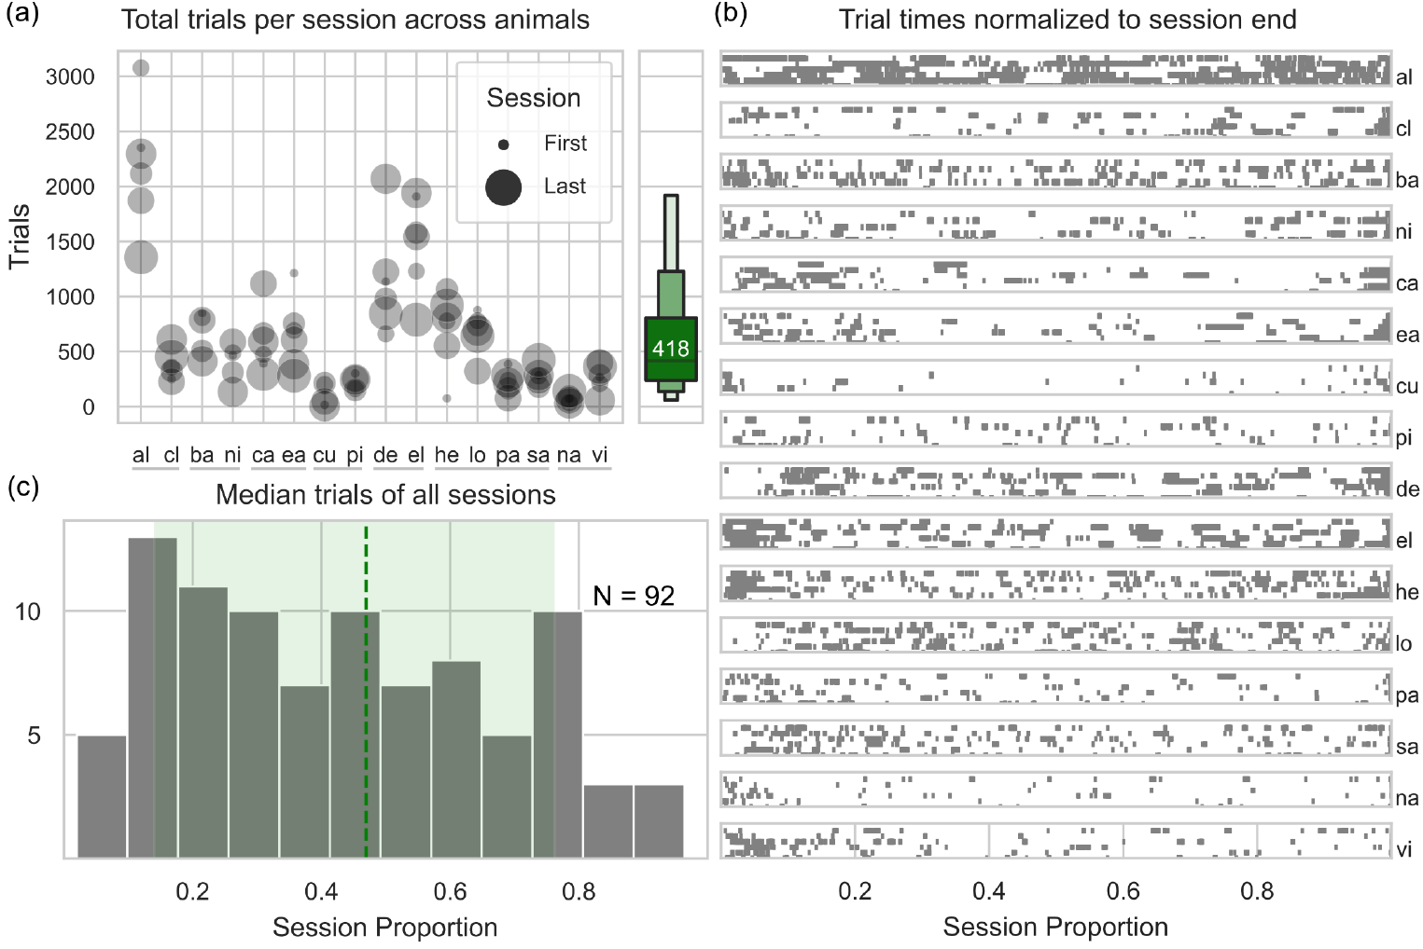
Voluntary engagement changes within a session
The rhesus macaques continued to engage with the multiple-choice interface across repeated sessions. The tasks were available for long periods, and trial participation was initiated by the animals rather than fixed by an experimenter on every attempt.
Within a session, more interaction occurred in the earlier portion than later. Stable engagement across days therefore coexisted with a change in participation during an individual day.
A camera recorded the animal initiating each trial so responses could be assigned to individuals sharing an enclosure. Individual identification preserved the relationship between a particular monkey's selections, its task performance and its pattern of voluntary participation.
Calapai et al. (2023), Fig. 2. Engagement across animals and session time.
Calapai et al. (2023)
22
Notes:
• The rhesus macaques continued to engage with the multiple-choice interface across repeated sessions. The tasks were available for long periods, and trial participation was initiated by the animals rather than fixed by an experimenter on every attempt.
• Within a session, more interaction occurred in the earlier portion than later. Stable engagement across days therefore coexisted with a change in participation during an individual day.
• A camera recorded the animal initiating each trial so responses could be assigned to individuals sharing an enclosure. Individual identification preserved the relationship between a particular monkey's selections, its task performance and its pattern of voluntary participation.
• The static and dynamic tasks delivered 0.37 mL of diluted juice after a correct touch. A failure produced different auditory feedback and no fluid. A trial without a response within 5 seconds ended without reward, after which the animal could select a task again.
References:
Calapai A, Pfefferle D, Cassidy LC, Nazari A, Yurt P, Brockhausen RR, Treue S (2023). A Touchscreen-Based, Multiple-Choice Approach to Cognitive Enrichment of Captive Rhesus Macaques (Macaca mulatta). Animals 13:2702. https://doi.org/10.3390/ani13172702
Figure: Calapai et al. (2023), Fig. 2. Engagement across animals and session time.
Figure source: https://doi.org/10.3390/ani13172702

Slide 23
A larger target also changes the opportunity for contact
Increasing a target's diameter increases the screen area occupied by a correct response. A rise in hit rate can therefore occur partly because more touch locations qualify as correct, even before any improvement in selective reaching.
Calapai and colleagues compared hit rates with the contact probability associated with target area. This separated the geometric opportunity to hit a stimulus from the component of performance exceeding that opportunity.
In the moving-target task, speed and size changed accuracy jointly. Correct responding above the area-based expectation connected screen engagement to selective visual and motor behavior, while the task-choice record identified which challenges each animal repeatedly selected.
Calapai et al. (2023), Fig. 4. Touch accuracy across target sizes and speeds.
Calapai et al. (2023)
23
Notes:
• Increasing a target's diameter increases the screen area occupied by a correct response. A rise in hit rate can therefore occur partly because more touch locations qualify as correct, even before any improvement in selective reaching.
• Calapai and colleagues compared hit rates with the contact probability associated with target area. This separated the geometric opportunity to hit a stimulus from the component of performance exceeding that opportunity.
• In the moving-target task, speed and size changed accuracy jointly. Correct responding above the area-based expectation connected screen engagement to selective visual and motor behavior, while the task-choice record identified which challenges each animal repeatedly selected.
• The static and dynamic tasks delivered 0.37 mL of diluted juice after a correct touch. A failure produced different auditory feedback and no fluid. A trial without a response within 5 seconds ended without reward, after which the animal could select a task again.
References:
Calapai A, Pfefferle D, Cassidy LC, Nazari A, Yurt P, Brockhausen RR, Treue S (2023). A Touchscreen-Based, Multiple-Choice Approach to Cognitive Enrichment of Captive Rhesus Macaques (Macaca mulatta). Animals 13:2702. https://doi.org/10.3390/ani13172702
Figure: Calapai et al. (2023), Fig. 4. Touch accuracy across target sizes and speeds.
Figure source: https://doi.org/10.3390/ani13172702

Slide 24
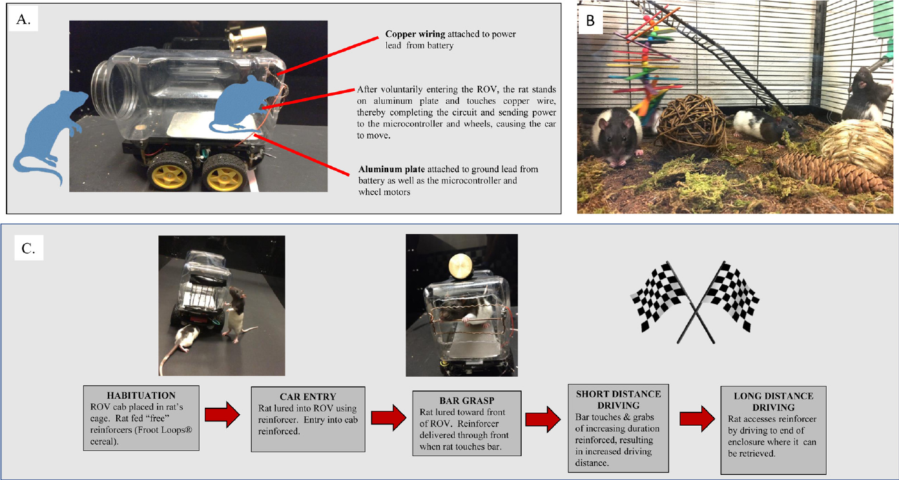
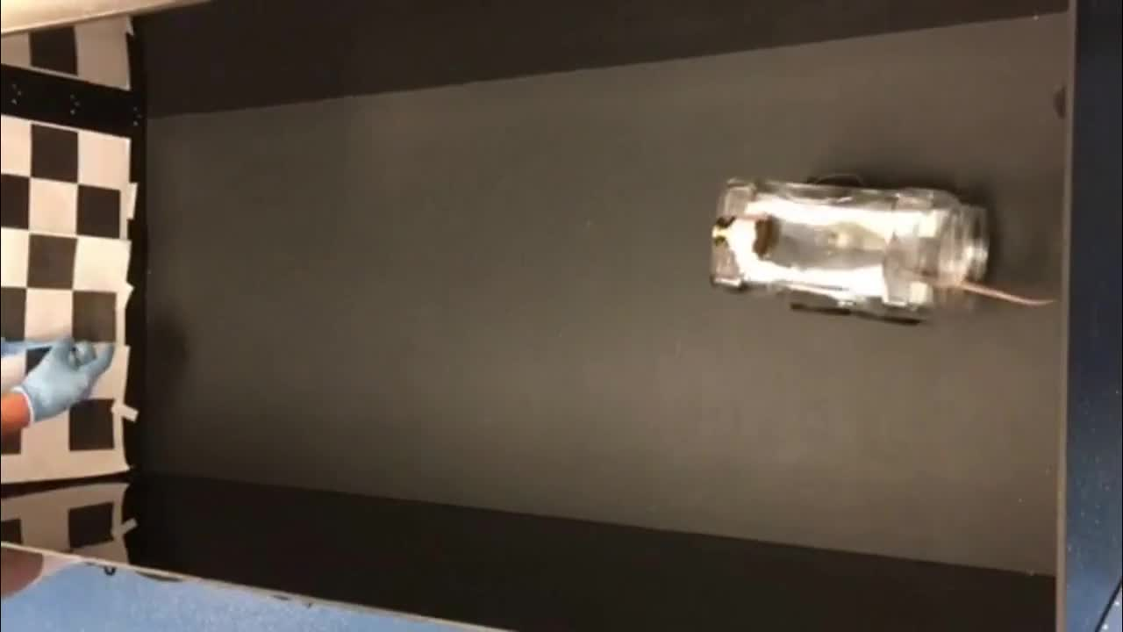
Rats move a vehicle by completing an electrical circuit
Crawford and colleagues built a rodent-operated vehicle, or ROV, with a transparent driver compartment on a motorized chassis. A rat standing on an aluminum floor plate could move the vehicle by touching copper bars.
Contact between the floor plate and a bar completed an electrical circuit through the animal's body. The resulting signal activated the controller and motors. Releasing the bar stopped movement, linking a discrete contact action to whole-body transport.
The controller translated contact into vehicle motion rather than requiring walking to move toward the destination. Voluntary entry into the compartment preceded the control action, so approaching the device and operating it were separable components of the trained behavior.
Crawford et al. (2020), Fig. 1. Rat-operated vehicle, housing and shaping procedure.
Crawford et al. (2020), article video: mmc2.mp4. Forward driving.
Crawford et al. (2020)
24
Notes:
• Crawford and colleagues built a rodent-operated vehicle, or ROV, with a transparent driver compartment on a motorized chassis. A rat standing on an aluminum floor plate could move the vehicle by touching copper bars.
• Contact between the floor plate and a bar completed an electrical circuit through the animal's body. The resulting signal activated the controller and motors. Releasing the bar stopped movement, linking a discrete contact action to whole-body transport.
• The controller translated contact into vehicle motion rather than requiring walking to move toward the destination. Voluntary entry into the compartment preceded the control action, so approaching the device and operating it were separable components of the trained behavior.
• The forward-driving experiment used a 150 cm arena with a checkerboard destination marker. Habituation to a similar container and the food preceded training. The later steering examples came from a separate preparation, so those flexible trajectories are not the housing-comparison trials.
References:
Crawford LE, Knouse LE, Kent M, Vavra D, Harding O, LeServe D, Fox N, Hu X, Li P, Glory C, Lambert KG (2020). Enriched environment exposure accelerates rodent driving skills. Behavioural Brain Research 378:112309. https://doi.org/10.1016/j.bbr.2019.112309
Figure: Crawford et al. (2020), Fig. 1. Rat-operated vehicle, housing and shaping procedure.
Figure source: https://doi.org/10.1016/j.bbr.2019.112309
Article-provided recording:
Crawford et al. (2020), article video: mmc2.mp4. Forward driving.
The original study recording retains its original sequence, audio, timing and source annotations. Click during PowerPoint Slide Show for full-screen playback. Its poster is an unedited frame. Google Slides imports can omit embedded video; upload the supplied MP4 to Drive and insert it as a video. PowerPoint GUI playback was unavailable for testing.
DOI: https://doi.org/10.1016/j.bbr.2019.112309
Original media: https://ars.els-cdn.com/content/image/1-s2.0-S0166432819311763-mmc2.mp4
Credit: original study authors and publisher.
License: Copyright Elsevier 2019; no separate reuse license stated in supplied article.

Slide 25
Driving is shaped from entering to reaching a goal
Before training, a container resembling the vehicle compartment was placed in the rats' home cages. Food rewards were also introduced in advance. Habituation, a reduction in responding to a repeatedly encountered stimulus, reduced novelty before driving contingencies were imposed.
Training reinforced vehicle entry, contact with the bars and increasingly long forward movements. The goal end of the arena carried a checkerboard marker, providing a visible destination for the driving response.
Food was available only through the vehicle task. Increasing the distance required before delivery progressively extended the same learned contact response into movement toward a remote goal, rather than reinforcing bar contact regardless of where the vehicle traveled.
Crawford et al. (2020), Fig. 1. Rat-operated vehicle, housing and shaping procedure.
Crawford et al. (2020)
25
Notes:
• Before training, a container resembling the vehicle compartment was placed in the rats' home cages. Food rewards were also introduced in advance. Habituation, a reduction in responding to a repeatedly encountered stimulus, reduced novelty before driving contingencies were imposed.
• Training reinforced vehicle entry, contact with the bars and increasingly long forward movements. The goal end of the arena carried a checkerboard marker, providing a visible destination for the driving response.
• Food was available only through the vehicle task. Increasing the distance required before delivery progressively extended the same learned contact response into movement toward a remote goal, rather than reinforcing bar contact regardless of where the vehicle traveled.
• The forward-driving experiment used a 150 cm arena with a checkerboard destination marker. Habituation to a similar container and the food preceded training. The later steering examples came from a separate preparation, so those flexible trajectories are not the housing-comparison trials.
References:
Crawford LE, Knouse LE, Kent M, Vavra D, Harding O, LeServe D, Fox N, Hu X, Li P, Glory C, Lambert KG (2020). Enriched environment exposure accelerates rodent driving skills. Behavioural Brain Research 378:112309. https://doi.org/10.1016/j.bbr.2019.112309
Figure: Crawford et al. (2020), Fig. 1. Rat-operated vehicle, housing and shaping procedure.
Figure source: https://doi.org/10.1016/j.bbr.2019.112309

Slide 26
Enriched housing changes experience before driving
The rat-driving experiment compared animals housed in a multilevel enriched enclosure with animals in standard cages. The enriched enclosure included natural and artificial objects that changed weekly, providing varied opportunities for movement and exploration.
Housing exposure preceded driving training by approximately four months. The comparison therefore tested how an extended history of environmental interaction related to acquiring a new machine-control task.
The enriched rats acquired robust driving responses more readily than the standard-housed rats. Environmental experience altered subsequent engagement with a novel interface, even though the vehicle's contact-to-motion rule was the same for both housing conditions.
Crawford et al. (2020), Fig. 1. Rat-operated vehicle, housing and shaping procedure.
Crawford et al. (2020)
26
Notes:
• The rat-driving experiment compared animals housed in a multilevel enriched enclosure with animals in standard cages. The enriched enclosure included natural and artificial objects that changed weekly, providing varied opportunities for movement and exploration.
• Housing exposure preceded driving training by approximately four months. The comparison therefore tested how an extended history of environmental interaction related to acquiring a new machine-control task.
• The enriched rats acquired robust driving responses more readily than the standard-housed rats. Environmental experience altered subsequent engagement with a novel interface, even though the vehicle's contact-to-motion rule was the same for both housing conditions.
• The forward-driving experiment used a 150 cm arena with a checkerboard destination marker. Habituation to a similar container and the food preceded training. The later steering examples came from a separate preparation, so those flexible trajectories are not the housing-comparison trials.
References:
Crawford LE, Knouse LE, Kent M, Vavra D, Harding O, LeServe D, Fox N, Hu X, Li P, Glory C, Lambert KG (2020). Enriched environment exposure accelerates rodent driving skills. Behavioural Brain Research 378:112309. https://doi.org/10.1016/j.bbr.2019.112309
Figure: Crawford et al. (2020), Fig. 1. Rat-operated vehicle, housing and shaping procedure.
Figure source: https://doi.org/10.1016/j.bbr.2019.112309

Slide 27
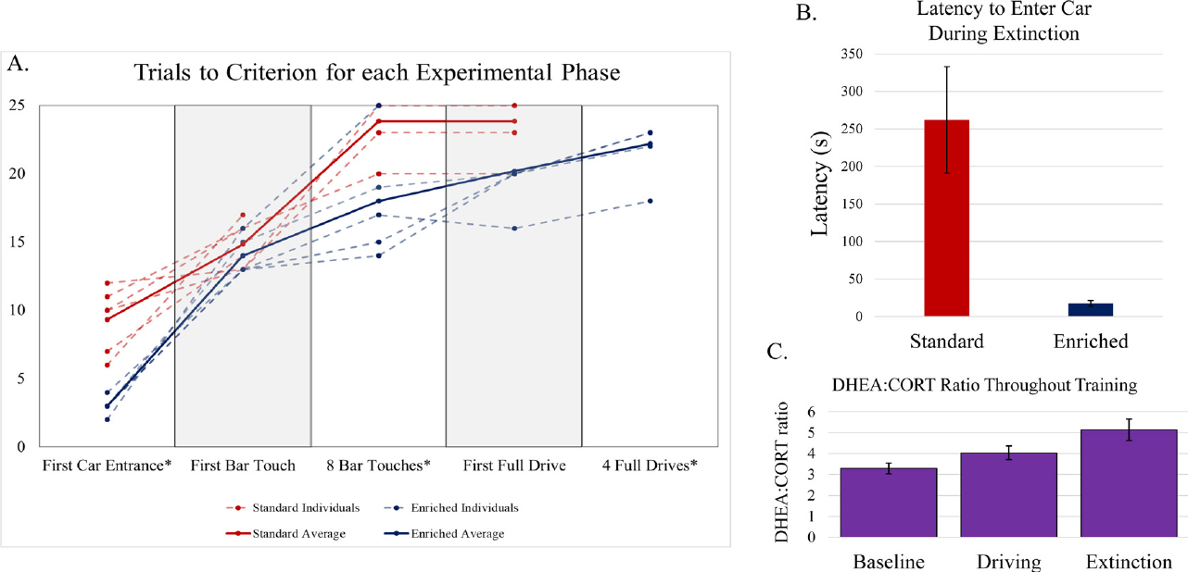
Approaching the vehicle and driving improve separately
Successful driving contained several stages: entering the vehicle, touching its controls and completing forward movement to the reward location. The investigators recorded progress through these stages rather than treating every unsuccessful trial as the same event.
Enriched-housed animals reached the entry and control criteria more readily. They also more effectively acquired repeated complete drives. The acquisition record linked participation with the eventual coordinated action sequence.
The vehicle was not simply a passive transport cage. The rat had to approach it, activate its contact controls and maintain the response while the surrounding scene changed. Improvements in this sequence depended on acquiring both willingness to engage and effective control.
Crawford et al. (2020), Fig. 2. Driving acquisition, extinction and endocrine measures.
Crawford et al. (2020)
27
Notes:
• Successful driving contained several stages: entering the vehicle, touching its controls and completing forward movement to the reward location. The investigators recorded progress through these stages rather than treating every unsuccessful trial as the same event.
• Enriched-housed animals reached the entry and control criteria more readily. They also more effectively acquired repeated complete drives. The acquisition record linked participation with the eventual coordinated action sequence.
• The vehicle was not simply a passive transport cage. The rat had to approach it, activate its contact controls and maintain the response while the surrounding scene changed. Improvements in this sequence depended on acquiring both willingness to engage and effective control.
• The forward-driving experiment used a 150 cm arena with a checkerboard destination marker. Habituation to a similar container and the food preceded training. The later steering examples came from a separate preparation, so those flexible trajectories are not the housing-comparison trials.
References:
Crawford LE, Knouse LE, Kent M, Vavra D, Harding O, LeServe D, Fox N, Hu X, Li P, Glory C, Lambert KG (2020). Enriched environment exposure accelerates rodent driving skills. Behavioural Brain Research 378:112309. https://doi.org/10.1016/j.bbr.2019.112309
Figure: Crawford et al. (2020), Fig. 2. Driving acquisition, extinction and endocrine measures.
Figure source: https://doi.org/10.1016/j.bbr.2019.112309

Slide 28
Extinction separates practiced actions from current food
Extinction is a change in behavior when an outcome that previously followed a response is withheld. After driving training, the rats encountered the vehicle in trials without an opportunity to obtain the usual food reward.
Enriched-housed animals continued to exhibit more interest in the vehicle during the extinction phase. Their entries into the device persisted even when current reinforcement was absent, relating housing history to engagement beyond rewarded training.
A previously reinforced interface can continue to recruit behavior after its immediate food consequence changes. The extinction comparison therefore added a measure of persistence to the acquisition record, rather than assuming that repeated vehicle entry was entirely determined by food available on that trial.
Crawford et al. (2020), Fig. 2. Driving acquisition, extinction and endocrine measures.
Crawford et al. (2020)
28
Notes:
• Extinction is a change in behavior when an outcome that previously followed a response is withheld. After driving training, the rats encountered the vehicle in trials without an opportunity to obtain the usual food reward.
• Enriched-housed animals continued to exhibit more interest in the vehicle during the extinction phase. Their entries into the device persisted even when current reinforcement was absent, relating housing history to engagement beyond rewarded training.
• A previously reinforced interface can continue to recruit behavior after its immediate food consequence changes. The extinction comparison therefore added a measure of persistence to the acquisition record, rather than assuming that repeated vehicle entry was entirely determined by food available on that trial.
• The forward-driving experiment used a 150 cm arena with a checkerboard destination marker. Habituation to a similar container and the food preceded training. The later steering examples came from a separate preparation, so those flexible trajectories are not the housing-comparison trials.
References:
Crawford LE, Knouse LE, Kent M, Vavra D, Harding O, LeServe D, Fox N, Hu X, Li P, Glory C, Lambert KG (2020). Enriched environment exposure accelerates rodent driving skills. Behavioural Brain Research 378:112309. https://doi.org/10.1016/j.bbr.2019.112309
Figure: Crawford et al. (2020), Fig. 2. Driving acquisition, extinction and endocrine measures.
Figure source: https://doi.org/10.1016/j.bbr.2019.112309

Slide 29
Training accompanies a change in endocrine measures
The investigators measured fecal metabolites of corticosterone, a glucocorticoid involved in stress responses, and dehydroepiandrosterone, or DHEA, a steroid considered alongside glucocorticoids in their analysis of emotional resilience.
The DHEA-to-corticosterone metabolite ratio increased during training and remained higher during extinction than at baseline. This pattern occurred in both housing conditions, separating the endocrine time course from the housing advantage in driving acquisition.
Fecal metabolites integrate hormone secretion and metabolism rather than measuring neural activity during a specific steering movement. The endocrine result accompanied the extended training experience, while the contact and trajectory records described performance of the learned motor sequence.
Crawford et al. (2020), Fig. 2. Driving acquisition, extinction and endocrine measures.
Crawford et al. (2020)
29
Notes:
• The investigators measured fecal metabolites of corticosterone, a glucocorticoid involved in stress responses, and dehydroepiandrosterone, or DHEA, a steroid considered alongside glucocorticoids in their analysis of emotional resilience.
• The DHEA-to-corticosterone metabolite ratio increased during training and remained higher during extinction than at baseline. This pattern occurred in both housing conditions, separating the endocrine time course from the housing advantage in driving acquisition.
• Fecal metabolites integrate hormone secretion and metabolism rather than measuring neural activity during a specific steering movement. The endocrine result accompanied the extended training experience, while the contact and trajectory records described performance of the learned motor sequence.
• The forward-driving experiment used a 150 cm arena with a checkerboard destination marker. Habituation to a similar container and the food preceded training. The later steering examples came from a separate preparation, so those flexible trajectories are not the housing-comparison trials.
References:
Crawford LE, Knouse LE, Kent M, Vavra D, Harding O, LeServe D, Fox N, Hu X, Li P, Glory C, Lambert KG (2020). Enriched environment exposure accelerates rodent driving skills. Behavioural Brain Research 378:112309. https://doi.org/10.1016/j.bbr.2019.112309
Figure: Crawford et al. (2020), Fig. 2. Driving acquisition, extinction and endocrine measures.
Figure source: https://doi.org/10.1016/j.bbr.2019.112309

Slide 30
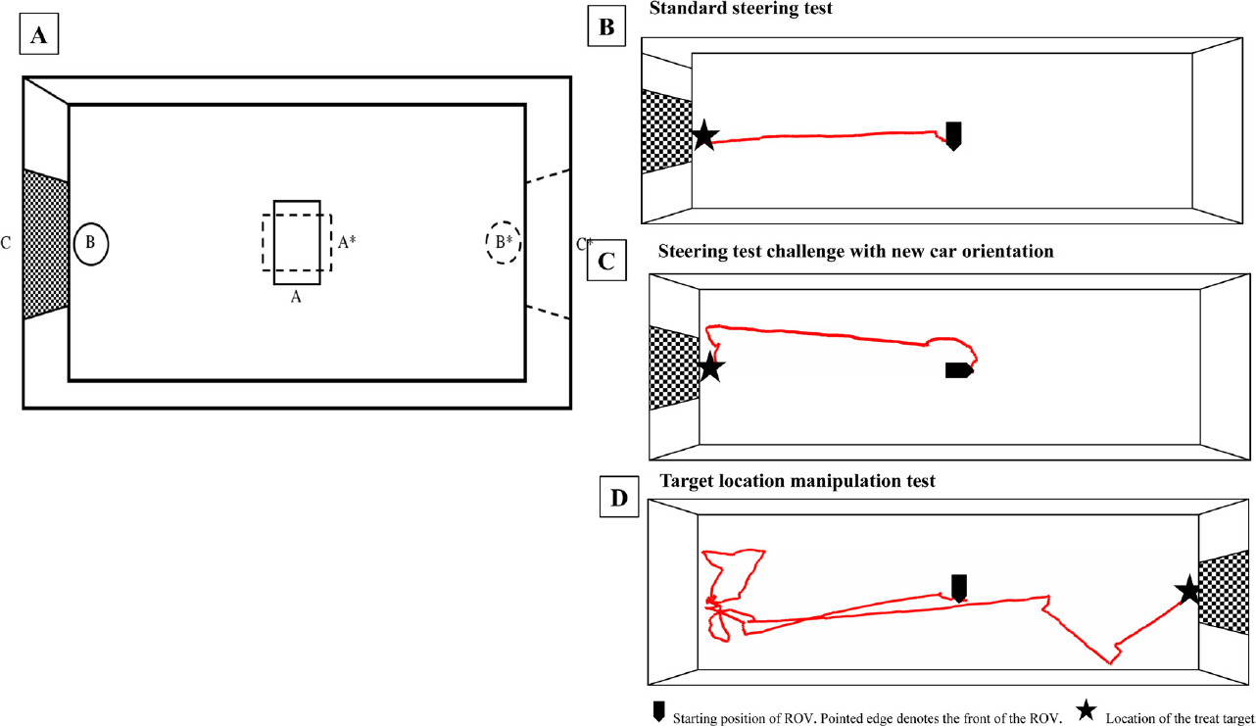
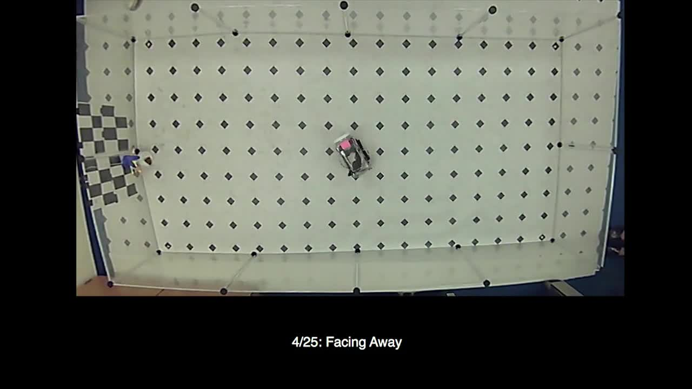
Changed start positions recruit corrective steering
In separate preliminary steering work, rats learned to move right, left or forward by contacting different bars. Goal-directed movement now required selecting among control contacts rather than maintaining only forward activation.
Changing the vehicle's start orientation and the reward station's location altered the direction needed to reach the goal. The trained rats adjusted their steering in response to these spatial changes, contacting the control corresponding to the needed turn.
The steering preparation involved extensive training, approximately nine months. Its flexible trajectories complemented the forward-driving housing experiment: one examined acquisition after different environmental histories, while the other examined selecting control actions when the vehicle-goal relationship changed.
Crawford et al. (2020), Fig. 3. Steering paths from changed vehicle and goal positions.
Crawford et al. (2020), article video: mmc1.mp4. Changed starts and goals.
Crawford et al. (2020)
30
Notes:
• In separate preliminary steering work, rats learned to move right, left or forward by contacting different bars. Goal-directed movement now required selecting among control contacts rather than maintaining only forward activation.
• Changing the vehicle's start orientation and the reward station's location altered the direction needed to reach the goal. The trained rats adjusted their steering in response to these spatial changes, contacting the control corresponding to the needed turn.
• The steering preparation involved extensive training, approximately nine months. Its flexible trajectories complemented the forward-driving housing experiment: one examined acquisition after different environmental histories, while the other examined selecting control actions when the vehicle-goal relationship changed.
• The forward-driving experiment used a 150 cm arena with a checkerboard destination marker. Habituation to a similar container and the food preceded training. The later steering examples came from a separate preparation, so those flexible trajectories are not the housing-comparison trials.
References:
Crawford LE, Knouse LE, Kent M, Vavra D, Harding O, LeServe D, Fox N, Hu X, Li P, Glory C, Lambert KG (2020). Enriched environment exposure accelerates rodent driving skills. Behavioural Brain Research 378:112309. https://doi.org/10.1016/j.bbr.2019.112309
Figure: Crawford et al. (2020), Fig. 3. Steering paths from changed vehicle and goal positions.
Figure source: https://doi.org/10.1016/j.bbr.2019.112309
Article-provided recording:
Crawford et al. (2020), article video: mmc1.mp4. Changed starts and goals.
The original study recording retains its original sequence, audio, timing and source annotations. Click during PowerPoint Slide Show for full-screen playback. Its poster is an unedited frame. Google Slides imports can omit embedded video; upload the supplied MP4 to Drive and insert it as a video. PowerPoint GUI playback was unavailable for testing.
DOI: https://doi.org/10.1016/j.bbr.2019.112309
Original media: https://ars.els-cdn.com/content/image/1-s2.0-S0166432819311763-mmc1.mp4
Credit: original study authors and publisher.
License: Copyright Elsevier 2019; no separate reuse license stated in supplied article.

Slide 31
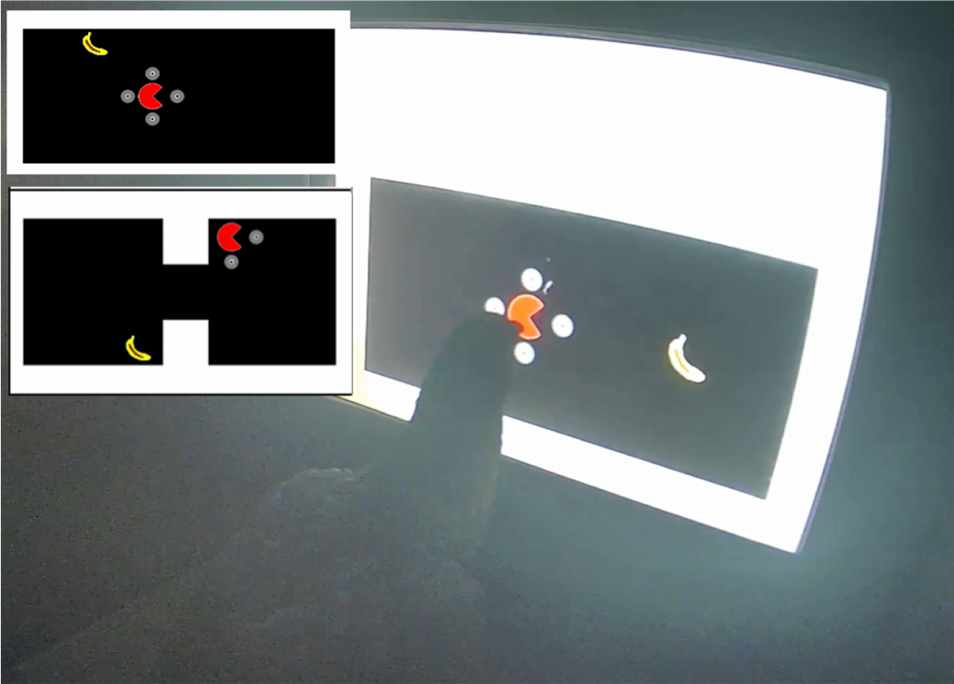
Pigeons steer a virtual avatar with directional pecks
Rodrigues and colleagues trained pigeons to navigate a virtual avatar, a screen object whose movements were controlled by the animal. The avatar resembled Pacman, and reaching a banana icon produced food access rather than a real banana.
Pecking the avatar exposed directional guides around it. A peck on a guide moved the avatar 120 pixels in that direction. The bird's beak contacted the screen locally while the controlled object moved through a larger virtual arena.
Pecking the banana itself had no effect. Reinforcement depended on moving the avatar to the goal, separating attraction to the visible target from learning the action that changed the avatar's position.
Rodrigues et al. (2026), Fig. 3. Pigeon operating the game and barrier layouts.
Rodrigues et al. (2026)
31
Notes:
• Rodrigues and colleagues trained pigeons to navigate a virtual avatar, a screen object whose movements were controlled by the animal. The avatar resembled Pacman, and reaching a banana icon produced food access rather than a real banana.
• Pecking the avatar exposed directional guides around it. A peck on a guide moved the avatar 120 pixels in that direction. The bird's beak contacted the screen locally while the controlled object moved through a larger virtual arena.
• Pecking the banana itself had no effect. Reinforcement depended on moving the avatar to the goal, separating attraction to the visible target from learning the action that changed the avatar's position.
• Directional guide pecks displaced the avatar by a fixed screen distance. Food consisted of 3.5 seconds of access to grain after goal contact. Portal training used a green spot, while novel puzzles used a banana, preserving the distinction between a practiced operation and its transfer to another goal.
References:
Rodrigues RS, Kirkman C, Garcia‐Mijares M, Blaisdell AP (2026). Pigeons, portals, and Pacman: Insightful problem solving and navigation using a touchscreen video game. Journal of the Experimental Analysis of Behavior 125:e70083. https://doi.org/10.1002/jeab.70083
Figure: Rodrigues et al. (2026), Fig. 3. Pigeon operating the game and barrier layouts.
Figure source: https://doi.org/10.1002/jeab.70083

Slide 32
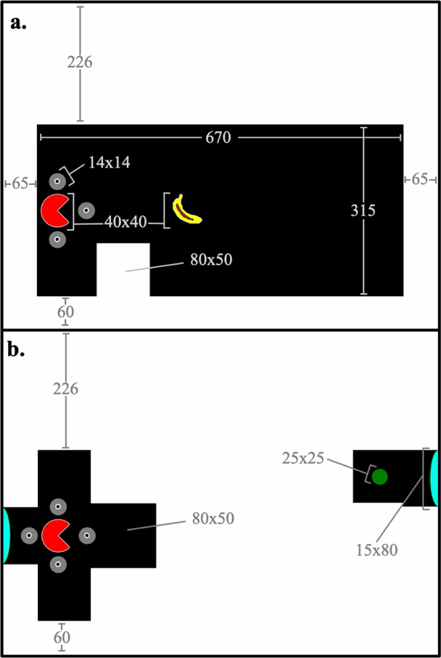
Training builds navigation from a two-response chain
The pigeons first learned to peck the avatar at fixed and then changing screen positions. Training subsequently introduced one directional guide, so an avatar peck followed by a guide peck became a response chain, a sequence with successive action requirements.
Presenting several guides made movement direction a choice. Initially, the banana was one step away; later it required two steps, including diagonal arrangements that demanded two different directional selections.
Trials with unrestricted steps allowed birds to continue navigating after an inefficient choice. Training thus changed from producing a required response to selecting successive movements toward a goal whose position varied, while food followed completion of the route.
Rodrigues et al. (2026), Fig. 2. Stimulus geometry for barrier and portal tasks.
Rodrigues et al. (2026)
32
Notes:
• The pigeons first learned to peck the avatar at fixed and then changing screen positions. Training subsequently introduced one directional guide, so an avatar peck followed by a guide peck became a response chain, a sequence with successive action requirements.
• Presenting several guides made movement direction a choice. Initially, the banana was one step away; later it required two steps, including diagonal arrangements that demanded two different directional selections.
• Trials with unrestricted steps allowed birds to continue navigating after an inefficient choice. Training thus changed from producing a required response to selecting successive movements toward a goal whose position varied, while food followed completion of the route.
• Directional guide pecks displaced the avatar by a fixed screen distance. Food consisted of 3.5 seconds of access to grain after goal contact. Portal training used a green spot, while novel puzzles used a banana, preserving the distinction between a practiced operation and its transfer to another goal.
References:
Rodrigues RS, Kirkman C, Garcia‐Mijares M, Blaisdell AP (2026). Pigeons, portals, and Pacman: Insightful problem solving and navigation using a touchscreen video game. Journal of the Experimental Analysis of Behavior 125:e70083. https://doi.org/10.1002/jeab.70083
Figure: Rodrigues et al. (2026), Fig. 2. Stimulus geometry for barrier and portal tasks.
Figure source: https://doi.org/10.1002/jeab.70083

Slide 33
Virtual barriers require detours rather than direct pursuit
A barrier occupied a cell within the pigeons' virtual arena and blocked avatar movement through that location. Direct movement toward a visible banana could therefore fail to provide a traversable route to it.
Training introduced one barrier and then two barriers. The avatar initially began to the left of the obstacle and the banana to the right; reversing these positions tested navigation with a changed start-to-goal arrangement.
The birds that progressed learned to move around the barriers. Final navigation quizzes varied the avatar and banana locations across the arena, requiring routes of two to nine steps at minimum. A successful movement sequence depended on both goal location and the space available around the obstacle.
Rodrigues et al. (2026), Fig. 3. Pigeon operating the game and barrier layouts.
Rodrigues et al. (2026)
33
Notes:
• A barrier occupied a cell within the pigeons' virtual arena and blocked avatar movement through that location. Direct movement toward a visible banana could therefore fail to provide a traversable route to it.
• Training introduced one barrier and then two barriers. The avatar initially began to the left of the obstacle and the banana to the right; reversing these positions tested navigation with a changed start-to-goal arrangement.
• The birds that progressed learned to move around the barriers. Final navigation quizzes varied the avatar and banana locations across the arena, requiring routes of two to nine steps at minimum. A successful movement sequence depended on both goal location and the space available around the obstacle.
• Directional guide pecks displaced the avatar by a fixed screen distance. Food consisted of 3.5 seconds of access to grain after goal contact. Portal training used a green spot, while novel puzzles used a banana, preserving the distinction between a practiced operation and its transfer to another goal.
References:
Rodrigues RS, Kirkman C, Garcia‐Mijares M, Blaisdell AP (2026). Pigeons, portals, and Pacman: Insightful problem solving and navigation using a touchscreen video game. Journal of the Experimental Analysis of Behavior 125:e70083. https://doi.org/10.1002/jeab.70083
Figure: Rodrigues et al. (2026), Fig. 3. Pigeon operating the game and barrier layouts.
Figure source: https://doi.org/10.1002/jeab.70083

Slide 34
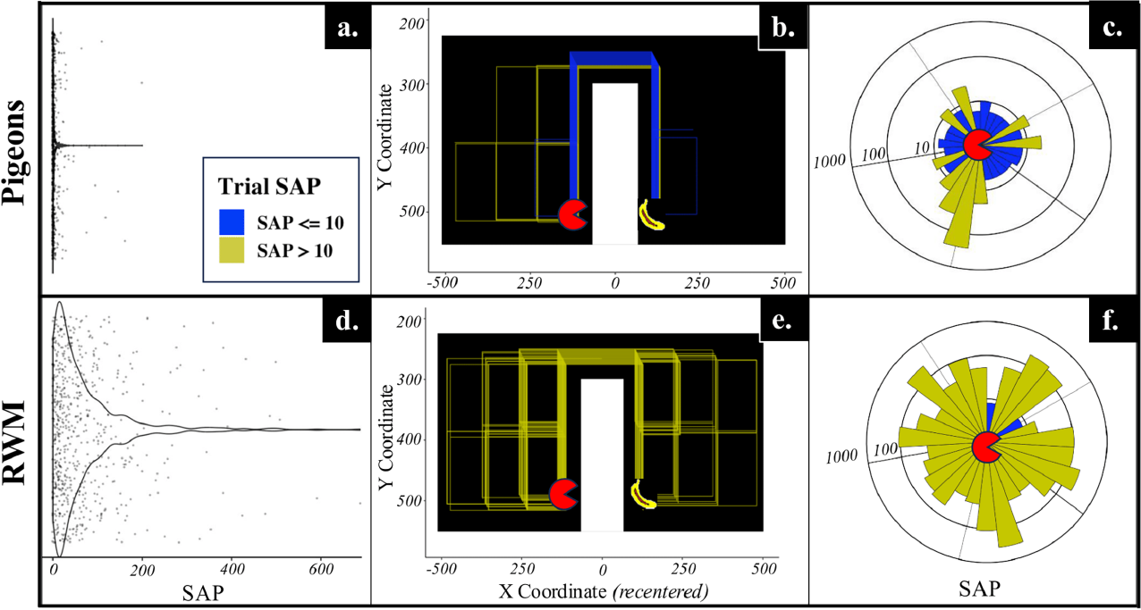
Pigeon routes differ from random directional choices
The investigators compared the pigeons' navigation with a random-walk control, a computer process that selected movement directions randomly under the same arena constraints. This supplied routes that could reach the banana without selective guidance toward it.
Performance was evaluated through route length, directional patterns and completion time. The trained pigeons reached goals with more efficient paths than the random control during barrier navigation, including reversed start-to-goal arrangements.
An individual trial could still contain unnecessary movements. Recording each avatar step retained the difference between a direct route, a corrected detour and prolonged wandering, linking successful reinforcement to the actual sequence of directional choices rather than target arrival alone.
Rodrigues et al. (2026), Fig. 5. Observed paths compared with random navigation.
Rodrigues et al. (2026)
34
Notes:
• The investigators compared the pigeons' navigation with a random-walk control, a computer process that selected movement directions randomly under the same arena constraints. This supplied routes that could reach the banana without selective guidance toward it.
• Performance was evaluated through route length, directional patterns and completion time. The trained pigeons reached goals with more efficient paths than the random control during barrier navigation, including reversed start-to-goal arrangements.
• An individual trial could still contain unnecessary movements. Recording each avatar step retained the difference between a direct route, a corrected detour and prolonged wandering, linking successful reinforcement to the actual sequence of directional choices rather than target arrival alone.
• Directional guide pecks displaced the avatar by a fixed screen distance. Food consisted of 3.5 seconds of access to grain after goal contact. Portal training used a green spot, while novel puzzles used a banana, preserving the distinction between a practiced operation and its transfer to another goal.
References:
Rodrigues RS, Kirkman C, Garcia‐Mijares M, Blaisdell AP (2026). Pigeons, portals, and Pacman: Insightful problem solving and navigation using a touchscreen video game. Journal of the Experimental Analysis of Behavior 125:e70083. https://doi.org/10.1002/jeab.70083
Figure: Rodrigues et al. (2026), Fig. 5. Observed paths compared with random navigation.
Figure source: https://doi.org/10.1002/jeab.70083

Slide 35
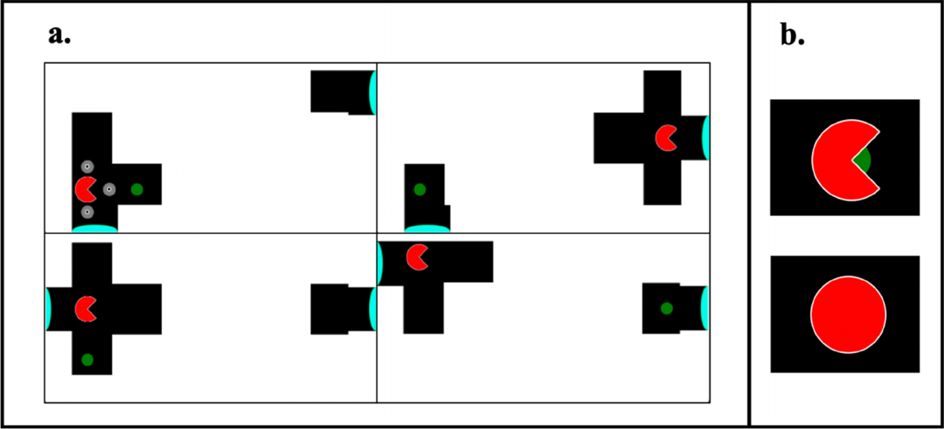
Portal use depends on where the goal can be reached
A portal was a screen location that transported the avatar to a linked location elsewhere in the arena. Portal training used a green spot as the goal, whereas earlier barrier navigation had used the banana icon.
On some trials, the green spot occupied a separated area that could be reached only through the portal. On other trials, it was accessible directly, so entering the portal moved the avatar away from the goal and delayed food access.
Both configurations occurred during training. The same portal stimulus could therefore support an efficient or inefficient choice depending on the goal's location. Pigeons learned conditional use of the portal rather than receiving food whenever they entered it.
Rodrigues et al. (2026), Fig. 4. Portal configurations and goal-contact feedback.
Rodrigues et al. (2026)
35
Notes:
• A portal was a screen location that transported the avatar to a linked location elsewhere in the arena. Portal training used a green spot as the goal, whereas earlier barrier navigation had used the banana icon.
• On some trials, the green spot occupied a separated area that could be reached only through the portal. On other trials, it was accessible directly, so entering the portal moved the avatar away from the goal and delayed food access.
• Both configurations occurred during training. The same portal stimulus could therefore support an efficient or inefficient choice depending on the goal's location. Pigeons learned conditional use of the portal rather than receiving food whenever they entered it.
• Directional guide pecks displaced the avatar by a fixed screen distance. Food consisted of 3.5 seconds of access to grain after goal contact. Portal training used a green spot, while novel puzzles used a banana, preserving the distinction between a practiced operation and its transfer to another goal.
References:
Rodrigues RS, Kirkman C, Garcia‐Mijares M, Blaisdell AP (2026). Pigeons, portals, and Pacman: Insightful problem solving and navigation using a touchscreen video game. Journal of the Experimental Analysis of Behavior 125:e70083. https://doi.org/10.1002/jeab.70083
Figure: Rodrigues et al. (2026), Fig. 4. Portal configurations and goal-contact feedback.
Figure source: https://doi.org/10.1002/jeab.70083

Slide 36
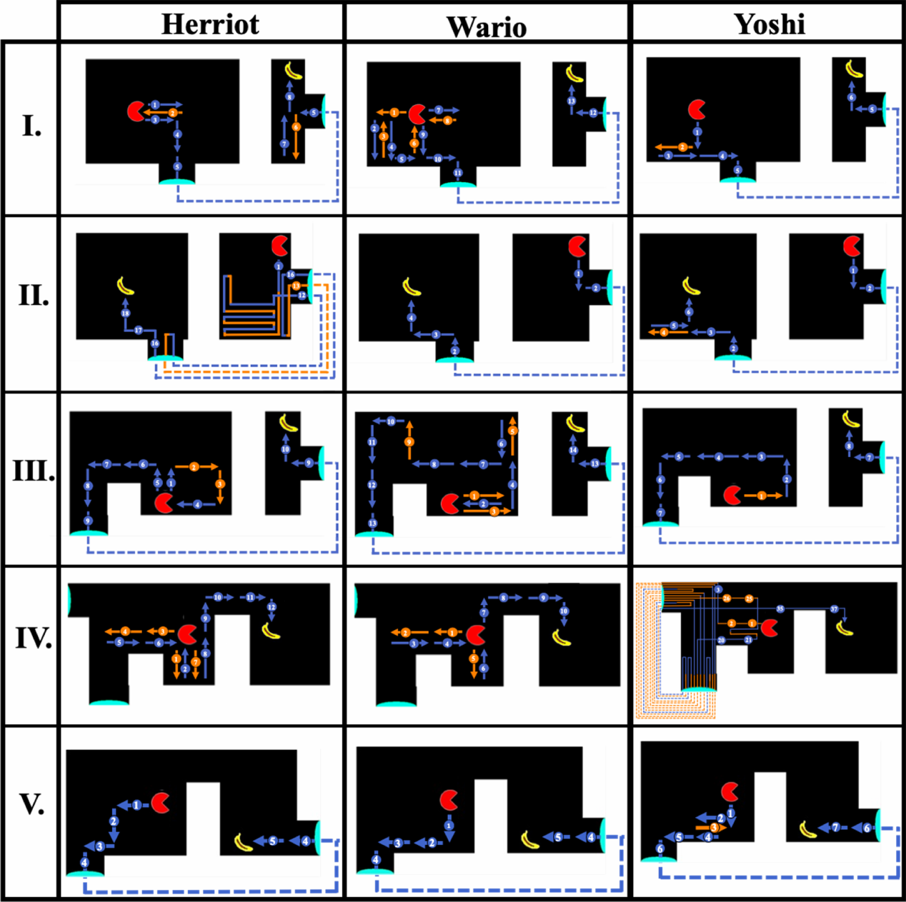
A learned portal function transfers to a new goal
The novel puzzles combined portals with barriers and restored the banana as the goal. During training, portal use had led only to the green spot, so reaching a banana through a portal required transfer between these task contexts.
In the first puzzle, each pigeon used a portal to bypass an impassable barrier and reached the banana on its initial encounter. Later puzzles reversed spatial arrangements or required a detour around another barrier before portal entry.
The authors proposed functional generalization, transfer of a learned operation to a different goal stimulus, as part of the explanation. Previously practiced navigation, portal entry and goal approach appeared together in new movement sequences whose order depended on the current screen arrangement.
Rodrigues et al. (2026), Fig. 6. First-trial paths across five novel puzzles.
Rodrigues et al. (2026)
36
Notes:
• The novel puzzles combined portals with barriers and restored the banana as the goal. During training, portal use had led only to the green spot, so reaching a banana through a portal required transfer between these task contexts.
• In the first puzzle, each pigeon used a portal to bypass an impassable barrier and reached the banana on its initial encounter. Later puzzles reversed spatial arrangements or required a detour around another barrier before portal entry.
• The authors proposed functional generalization, transfer of a learned operation to a different goal stimulus, as part of the explanation. Previously practiced navigation, portal entry and goal approach appeared together in new movement sequences whose order depended on the current screen arrangement.
• Directional guide pecks displaced the avatar by a fixed screen distance. Food consisted of 3.5 seconds of access to grain after goal contact. Portal training used a green spot, while novel puzzles used a banana, preserving the distinction between a practiced operation and its transfer to another goal.
References:
Rodrigues RS, Kirkman C, Garcia‐Mijares M, Blaisdell AP (2026). Pigeons, portals, and Pacman: Insightful problem solving and navigation using a touchscreen video game. Journal of the Experimental Analysis of Behavior 125:e70083. https://doi.org/10.1002/jeab.70083
Figure: Rodrigues et al. (2026), Fig. 6. First-trial paths across five novel puzzles.
Figure source: https://doi.org/10.1002/jeab.70083

Slide 37
Reward history can attract unhelpful portal use
Puzzle IV placed the banana within reach by ordinary navigation, making portal use unnecessary. Herriot and Wario initially completed the route without using a portal, while Yoshi repeatedly entered and exited the portals for about 4.5 minutes before reaching the banana.
On its next encounter, Yoshi navigated directly to the goal without a portal. Herriot and Wario also became caught in portal loops on later trials, despite their initially effective choices.
The authors hypothesized that the portal had acquired control over responding through its earlier relationship with food. Attraction to a previously useful operation competed with the route required by the present layout, and additional encounters changed which trained actions controlled navigation.
Rodrigues et al. (2026), Fig. 6. First-trial paths across five novel puzzles.
Rodrigues et al. (2026)
37
Notes:
• Puzzle IV placed the banana within reach by ordinary navigation, making portal use unnecessary. Herriot and Wario initially completed the route without using a portal, while Yoshi repeatedly entered and exited the portals for about 4.5 minutes before reaching the banana.
• On its next encounter, Yoshi navigated directly to the goal without a portal. Herriot and Wario also became caught in portal loops on later trials, despite their initially effective choices.
• The authors hypothesized that the portal had acquired control over responding through its earlier relationship with food. Attraction to a previously useful operation competed with the route required by the present layout, and additional encounters changed which trained actions controlled navigation.
• Directional guide pecks displaced the avatar by a fixed screen distance. Food consisted of 3.5 seconds of access to grain after goal contact. Portal training used a green spot, while novel puzzles used a banana, preserving the distinction between a practiced operation and its transfer to another goal.
References:
Rodrigues RS, Kirkman C, Garcia‐Mijares M, Blaisdell AP (2026). Pigeons, portals, and Pacman: Insightful problem solving and navigation using a touchscreen video game. Journal of the Experimental Analysis of Behavior 125:e70083. https://doi.org/10.1002/jeab.70083
Figure: Rodrigues et al. (2026), Fig. 6. First-trial paths across five novel puzzles.
Figure source: https://doi.org/10.1002/jeab.70083

Slide 38
Equal-length routes reveal preferences beyond efficiency
Puzzle V offered two routes to the banana: direct navigation around a barrier or travel through a portal. Each route required a minimum of five steps, so entering the portal provided no shortest-path advantage over ordinary navigation.
All pigeons chose the portal on their first encounter. Across repeated trials, portal use remained more common, but Herriot and Wario also completed some trials by navigating directly around the barrier.
Performance improved across repetitions of this puzzle. The equal-length routes separated preference for a learned operation from its objective path-length benefit, while the alternative successful trajectories recorded flexibility in selecting different action sequences to reach the same goal.
Rodrigues et al. (2026), Fig. 6. First-trial paths across five novel puzzles.
Rodrigues et al. (2026)
38
Notes:
• Puzzle V offered two routes to the banana: direct navigation around a barrier or travel through a portal. Each route required a minimum of five steps, so entering the portal provided no shortest-path advantage over ordinary navigation.
• All pigeons chose the portal on their first encounter. Across repeated trials, portal use remained more common, but Herriot and Wario also completed some trials by navigating directly around the barrier.
• Performance improved across repetitions of this puzzle. The equal-length routes separated preference for a learned operation from its objective path-length benefit, while the alternative successful trajectories recorded flexibility in selecting different action sequences to reach the same goal.
• Directional guide pecks displaced the avatar by a fixed screen distance. Food consisted of 3.5 seconds of access to grain after goal contact. Portal training used a green spot, while novel puzzles used a banana, preserving the distinction between a practiced operation and its transfer to another goal.
References:
Rodrigues RS, Kirkman C, Garcia‐Mijares M, Blaisdell AP (2026). Pigeons, portals, and Pacman: Insightful problem solving and navigation using a touchscreen video game. Journal of the Experimental Analysis of Behavior 125:e70083. https://doi.org/10.1002/jeab.70083
Figure: Rodrigues et al. (2026), Fig. 6. First-trial paths across five novel puzzles.
Figure source: https://doi.org/10.1002/jeab.70083

Slide 39
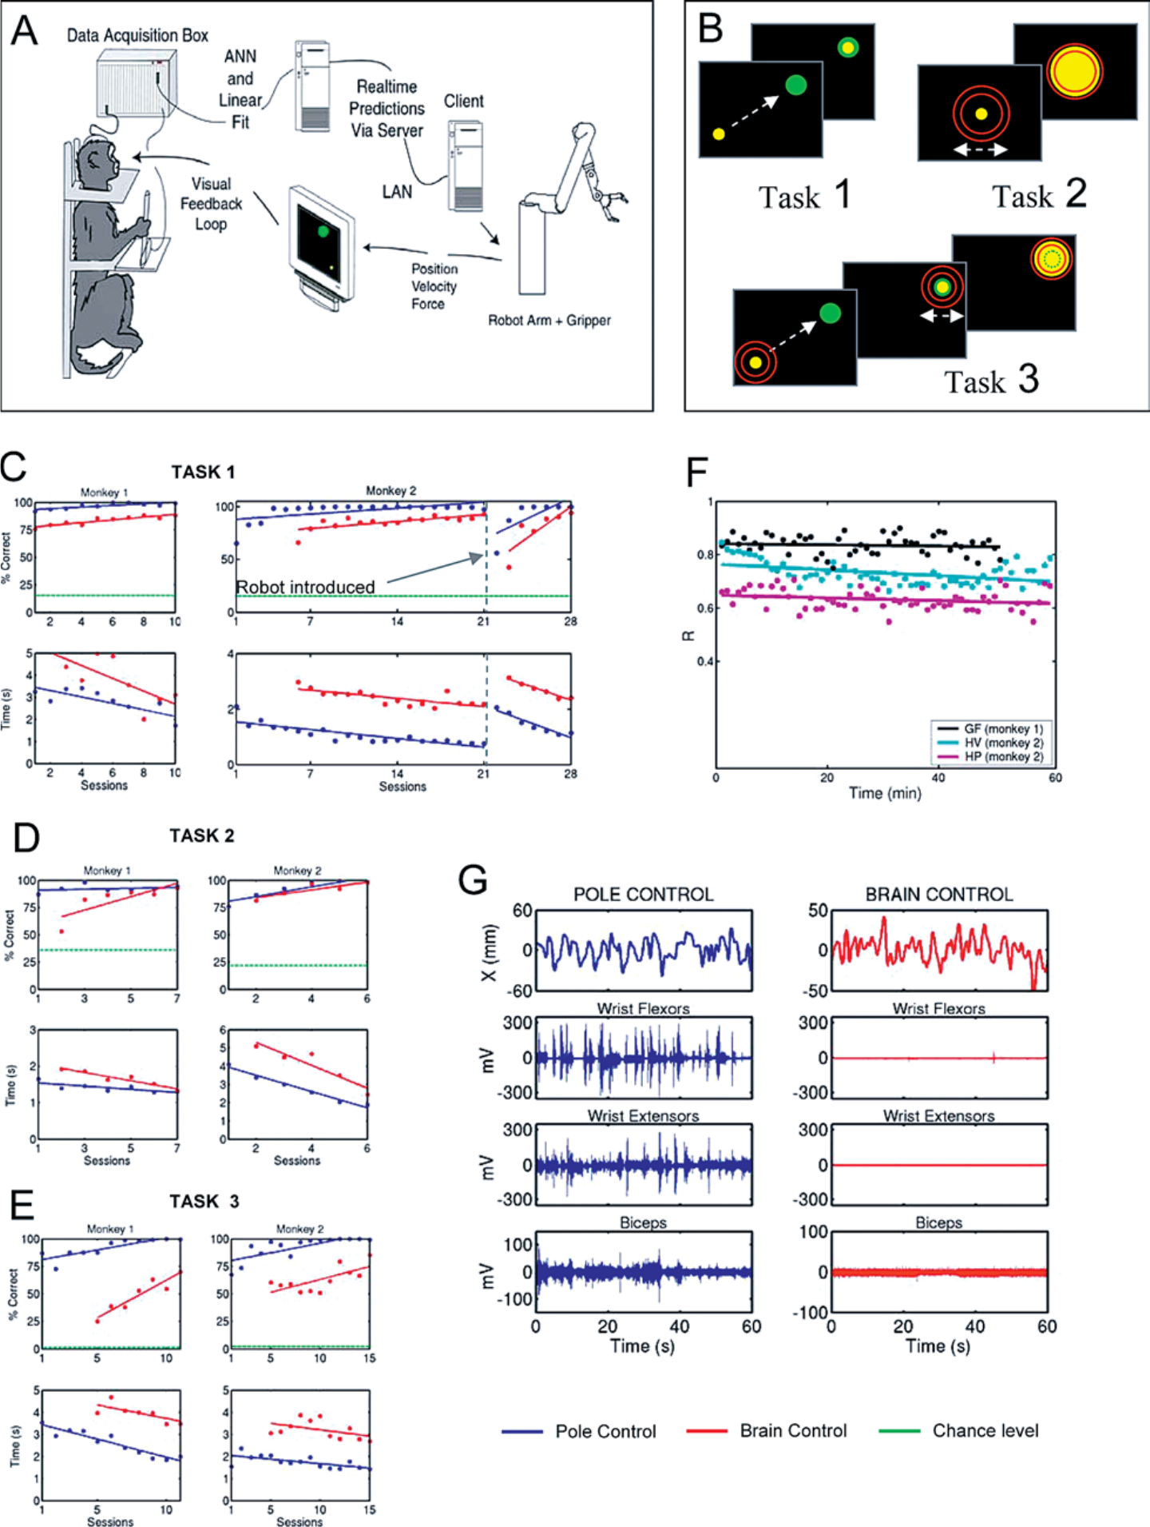
Neural activity can control reaching on a screen
Carmena and colleagues trained macaques to move a cursor toward a target and to control a virtual grip. During initial training, the animal manipulated a handheld pole while electrodes recorded activity from populations of neurons in the cortex, the brain’s outer gray matter. The recordings captured action potentials, the brief electrical spikes generated by neurons.
A brain–machine interface used recorded activity to predict movement parameters. The controller could then move the cursor using those predictions rather than the pole's current displacement.
The animal received continuous visual feedback about cursor position and grip. Switching from pole control to neural control changed the source of the computer command while preserving the visible goal, allowing the same practiced task to be performed through a different output pathway.
Carmena et al. (2003), Fig. 1. Neural interface, behavioral tasks and muscle recordings.
Carmena et al. (2003)
39
Notes:
• Carmena and colleagues trained macaques to move a cursor toward a target and to control a virtual grip. During initial training, the animal manipulated a handheld pole while electrodes recorded activity from populations of neurons in the cortex, the brain’s outer gray matter. The recordings captured action potentials, the brief electrical spikes generated by neurons.
• A brain–machine interface used recorded activity to predict movement parameters. The controller could then move the cursor using those predictions rather than the pole's current displacement.
• The animal received continuous visual feedback about cursor position and grip. Switching from pole control to neural control changed the source of the computer command while preserving the visible goal, allowing the same practiced task to be performed through a different output pathway.
• The reaching and grasping tasks provided separate visual feedback about position and grip. When a robot was included, its measured position and force were represented on the screen. The resulting feedback described what the external actuator actually did, allowing the animal to adjust its neural control.
References:
Carmena JM, Lebedev MA, Crist RE, O'Doherty JE, Santucci DM, Dimitrov DF, Patil PG, Henriquez CS, Nicolelis MAL (2003). Learning to Control a Brain–Machine Interface for Reaching and Grasping by Primates. PLoS Biology 1:e42. https://doi.org/10.1371/journal.pbio.0000042
Figure: Carmena et al. (2003), Fig. 1. Neural interface, behavioral tasks and muscle recordings.
Figure source: https://doi.org/10.1371/journal.pbio.0000042

Slide 40
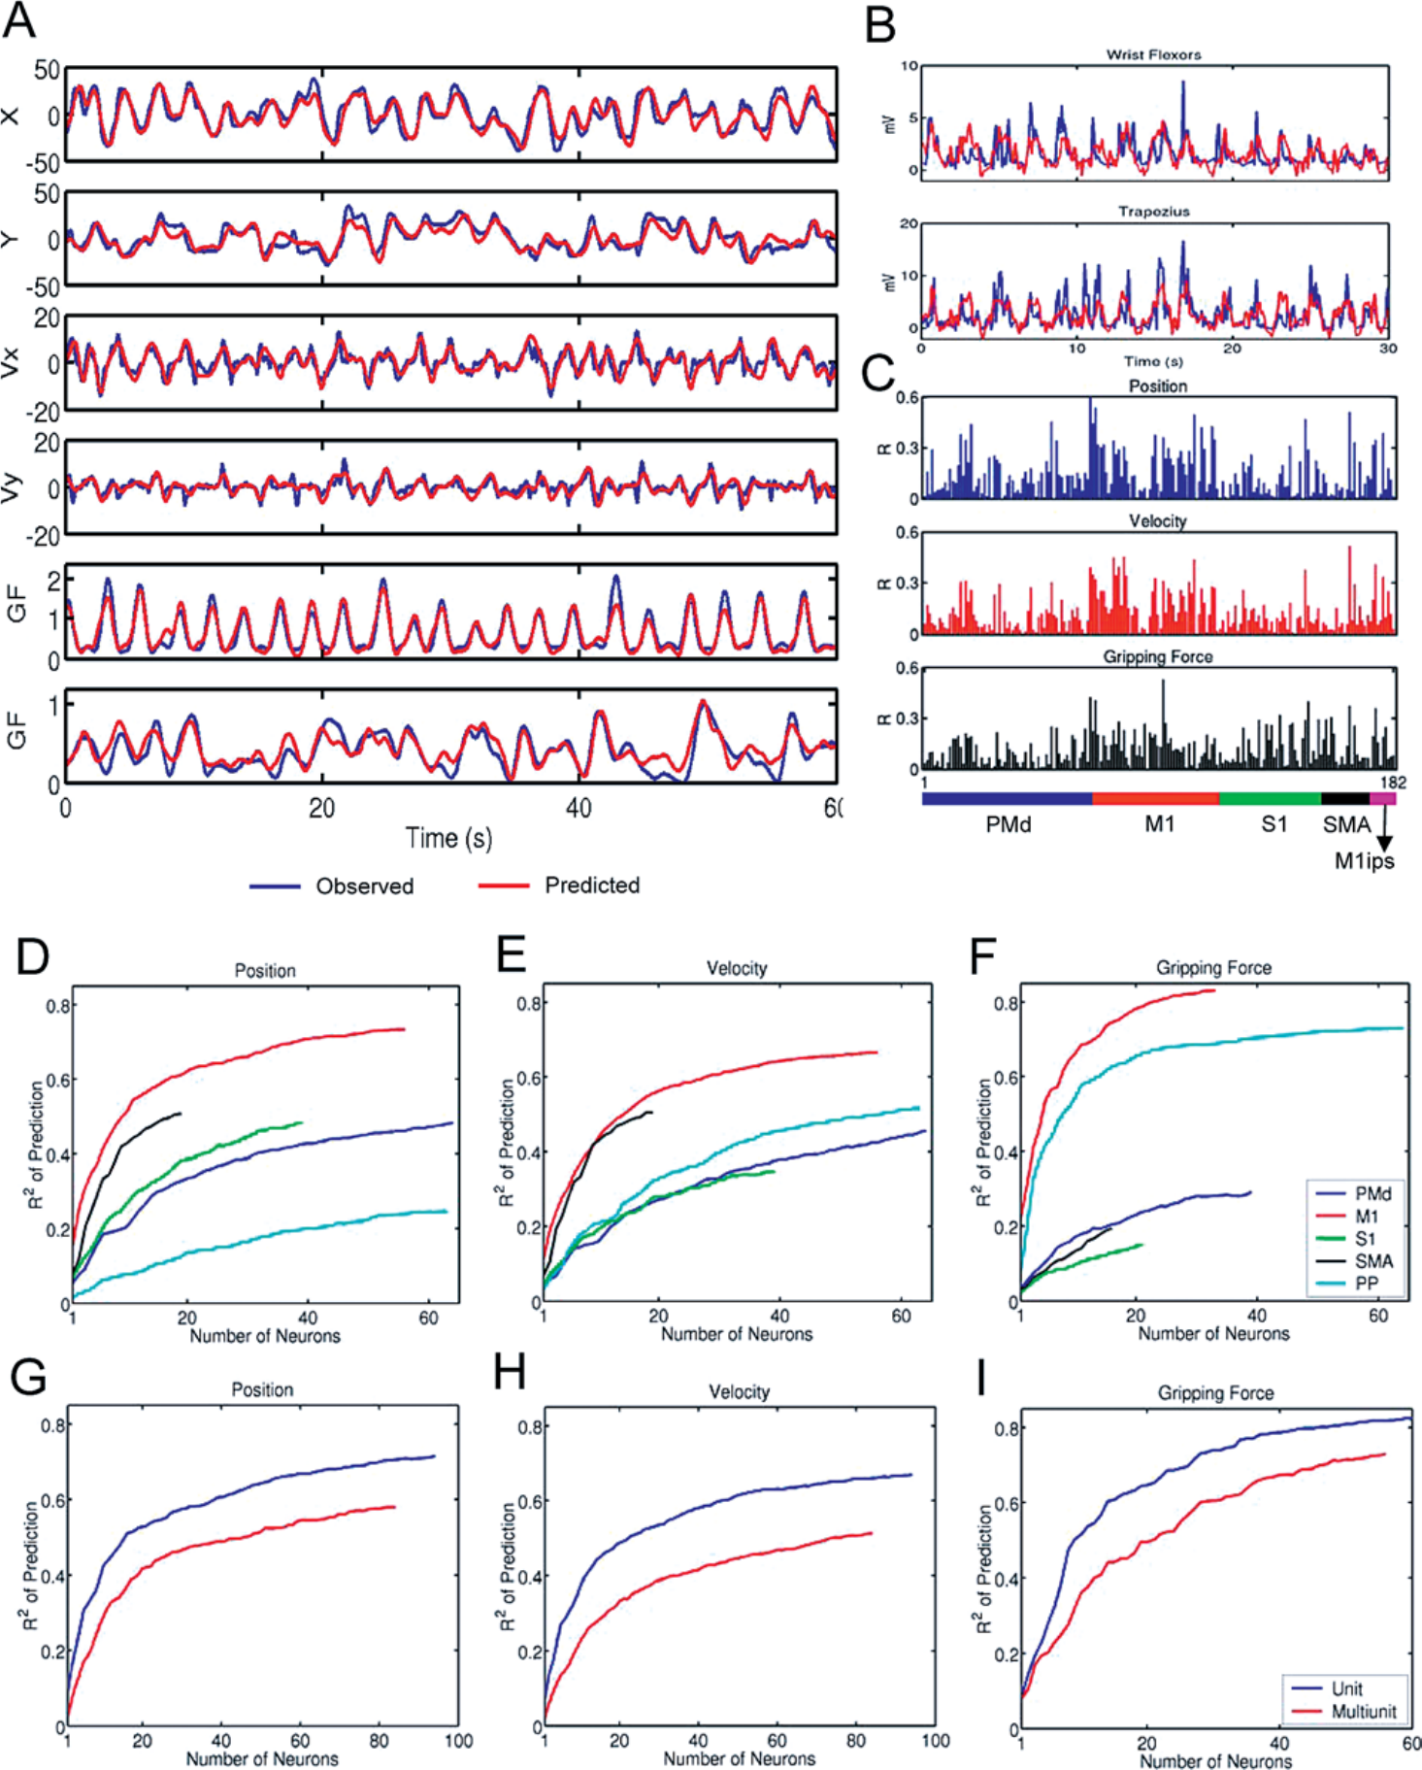
A decoder links population firing to motor parameters
A decoder is a model translating recorded neural activity into an output command. In Carmena's preparation, models predicted hand position, velocity and gripping force from the activity of cortical neuronal ensembles.
During an initial pole-control period, recorded activity was paired with measured movement. Model coefficients were then fixed before the animal controlled the cursor through the neural interface. Improvement could occur while the activity-to-command transformation remained stable.
The same population carried information about several movement parameters. Combining neuronal activity supplied a usable control signal for reaching and grip rather than assigning one recorded neuron to a single complete movement or treating all cortical activity as interchangeable.
Carmena et al. (2003), Fig. 2. Movement predictions from cortical population activity.
Carmena et al. (2003)
40
Notes:
• A decoder is a model translating recorded neural activity into an output command. In Carmena's preparation, models predicted hand position, velocity and gripping force from the activity of cortical neuronal ensembles.
• During an initial pole-control period, recorded activity was paired with measured movement. Model coefficients were then fixed before the animal controlled the cursor through the neural interface. Improvement could occur while the activity-to-command transformation remained stable.
• The same population carried information about several movement parameters. Combining neuronal activity supplied a usable control signal for reaching and grip rather than assigning one recorded neuron to a single complete movement or treating all cortical activity as interchangeable.
• The reaching and grasping tasks provided separate visual feedback about position and grip. When a robot was included, its measured position and force were represented on the screen. The resulting feedback described what the external actuator actually did, allowing the animal to adjust its neural control.
References:
Carmena JM, Lebedev MA, Crist RE, O'Doherty JE, Santucci DM, Dimitrov DF, Patil PG, Henriquez CS, Nicolelis MAL (2003). Learning to Control a Brain–Machine Interface for Reaching and Grasping by Primates. PLoS Biology 1:e42. https://doi.org/10.1371/journal.pbio.0000042
Figure: Carmena et al. (2003), Fig. 2. Movement predictions from cortical population activity.
Figure source: https://doi.org/10.1371/journal.pbio.0000042

Slide 41
Brain control continues without arm movement
The macaques initially moved their arms during brain control, continuing the behavior associated with pole manipulation. With experience, they produced periods of effective cursor control while their arms remained still.
Electromyography, or EMG, records electrical activity associated with muscle activation. Surface EMG from arm muscles lost its movement-linked modulation during these periods, while the neural decoder continued moving the cursor.
Removing the pole further separated neural control from the original mechanical action. The task could be completed through cortical activity and visual feedback without the arm providing the immediate movement signal used during initial training.
Carmena et al. (2003), Fig. 1. Neural interface, behavioral tasks and muscle recordings.
Carmena et al. (2003)
41
Notes:
• The macaques initially moved their arms during brain control, continuing the behavior associated with pole manipulation. With experience, they produced periods of effective cursor control while their arms remained still.
• Electromyography, or EMG, records electrical activity associated with muscle activation. Surface EMG from arm muscles lost its movement-linked modulation during these periods, while the neural decoder continued moving the cursor.
• Removing the pole further separated neural control from the original mechanical action. The task could be completed through cortical activity and visual feedback without the arm providing the immediate movement signal used during initial training.
• The reaching and grasping tasks provided separate visual feedback about position and grip. When a robot was included, its measured position and force were represented on the screen. The resulting feedback described what the external actuator actually did, allowing the animal to adjust its neural control.
References:
Carmena JM, Lebedev MA, Crist RE, O'Doherty JE, Santucci DM, Dimitrov DF, Patil PG, Henriquez CS, Nicolelis MAL (2003). Learning to Control a Brain–Machine Interface for Reaching and Grasping by Primates. PLoS Biology 1:e42. https://doi.org/10.1371/journal.pbio.0000042
Figure: Carmena et al. (2003), Fig. 1. Neural interface, behavioral tasks and muscle recordings.
Figure source: https://doi.org/10.1371/journal.pbio.0000042

Slide 42
Robot dynamics change the animal’s control problem
A real robot arm and gripper were introduced into the closed control loop. Robot position determined the displayed cursor location, and gripper force determined cursor size. The visual feedback now represented a physical actuator's response.
The robot introduced a 60–90 ms delay between decoder output and movement. Initial performance declined when these dynamics entered the loop, even though the target-selection rule remained unchanged.
Practice restored performance over approximately seven training sessions. The animal adjusted to consequences imposed by the actuator, linking skill acquisition to the timing and dynamics of the controlled device as well as to the neural decoder's immediate output.
Carmena et al. (2003), Fig. 1. Neural interface, behavioral tasks and muscle recordings.
Carmena et al. (2003)
42
Notes:
• A real robot arm and gripper were introduced into the closed control loop. Robot position determined the displayed cursor location, and gripper force determined cursor size. The visual feedback now represented a physical actuator's response.
• The robot introduced a 60–90 ms delay between decoder output and movement. Initial performance declined when these dynamics entered the loop, even though the target-selection rule remained unchanged.
• Practice restored performance over approximately seven training sessions. The animal adjusted to consequences imposed by the actuator, linking skill acquisition to the timing and dynamics of the controlled device as well as to the neural decoder's immediate output.
• The reaching and grasping tasks provided separate visual feedback about position and grip. When a robot was included, its measured position and force were represented on the screen. The resulting feedback described what the external actuator actually did, allowing the animal to adjust its neural control.
References:
Carmena JM, Lebedev MA, Crist RE, O'Doherty JE, Santucci DM, Dimitrov DF, Patil PG, Henriquez CS, Nicolelis MAL (2003). Learning to Control a Brain–Machine Interface for Reaching and Grasping by Primates. PLoS Biology 1:e42. https://doi.org/10.1371/journal.pbio.0000042
Figure: Carmena et al. (2003), Fig. 1. Neural interface, behavioral tasks and muscle recordings.
Figure source: https://doi.org/10.1371/journal.pbio.0000042

Slide 43
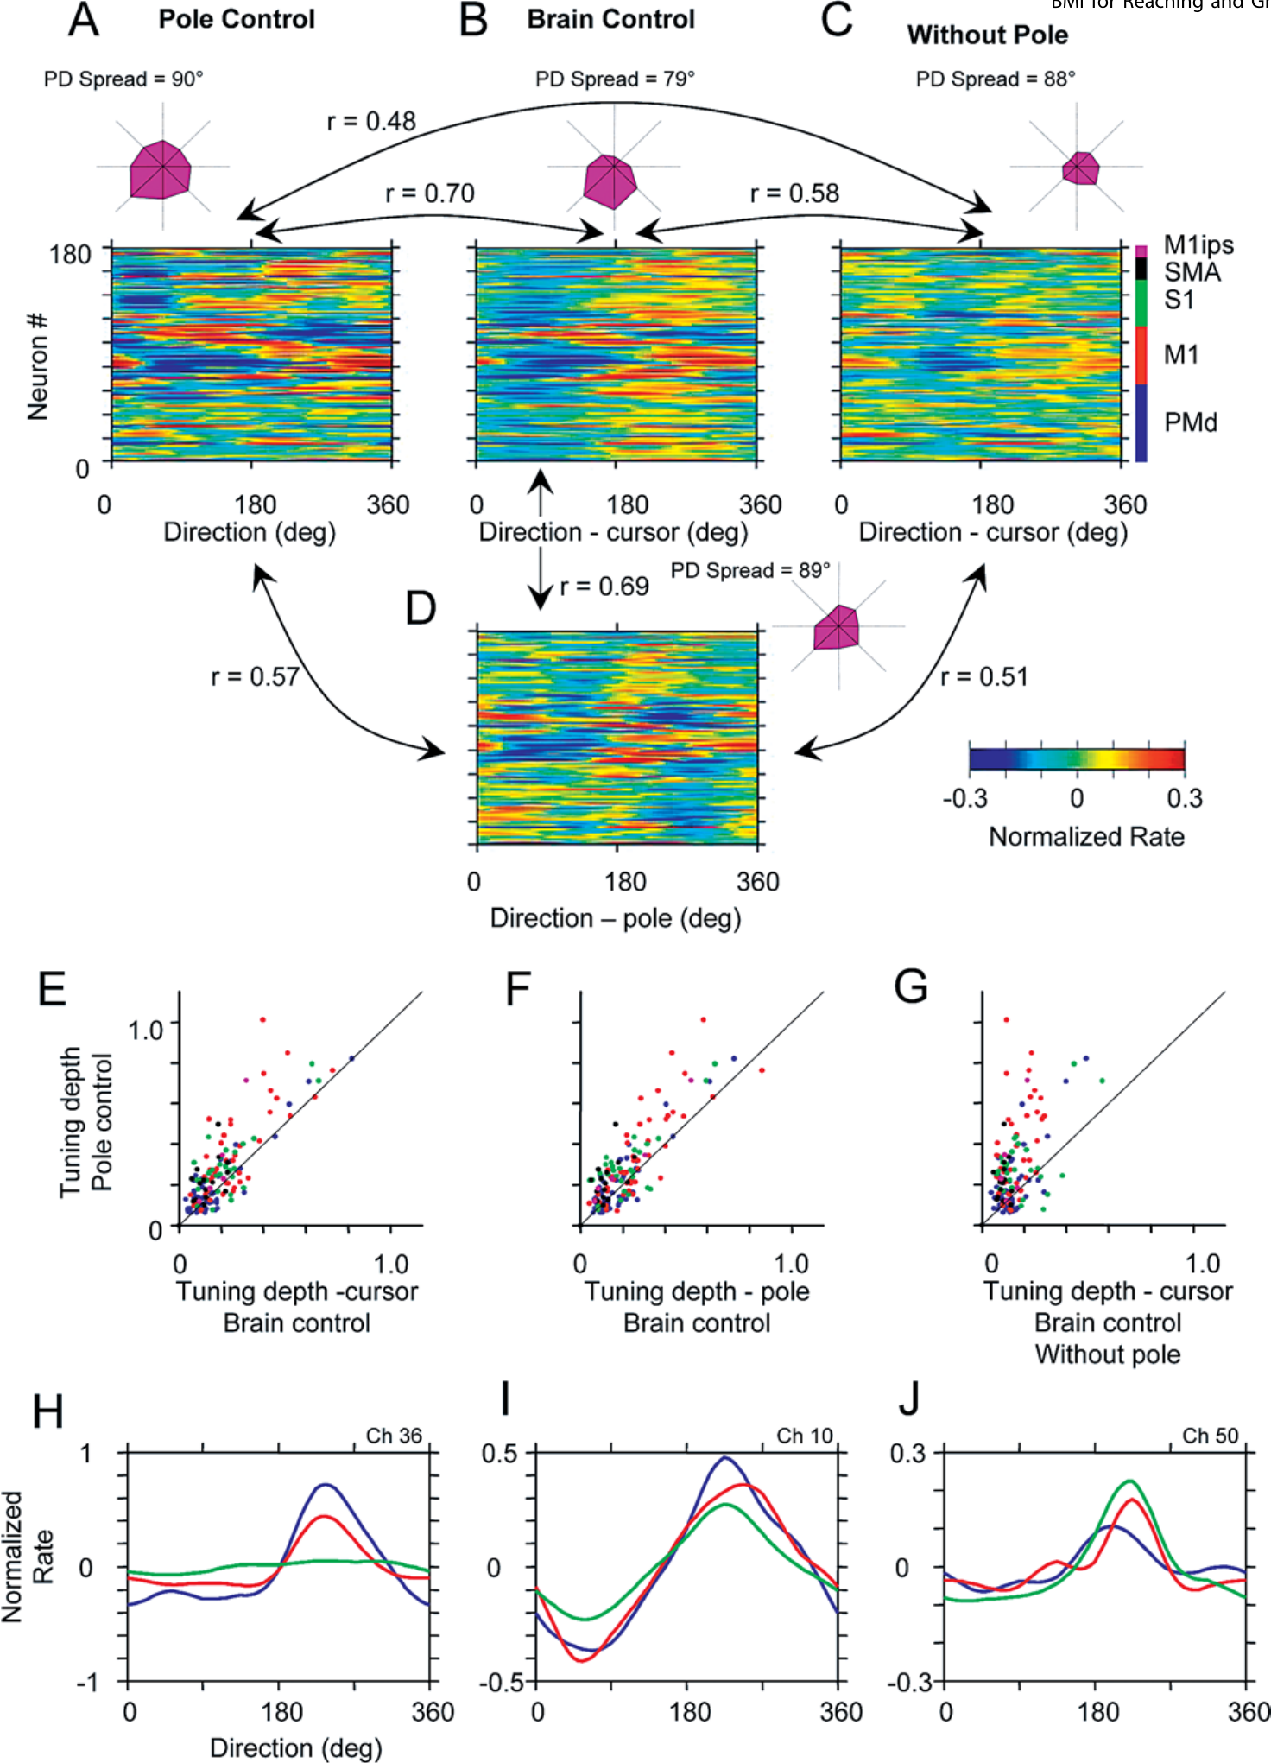
Directional tuning changes across control modes
Directional tuning is a relationship between a neuron's firing and the direction of movement. Carmena and colleagues compared this relationship during pole control, brain control with arm movement and brain control without arm movement.
Neuronal firing patterns changed when control shifted between these conditions. The cortical population's activity was therefore not a fixed copy of the same arm movement replayed unchanged through every interface.
The recorded tuning patterns linked the visual task to the active control mode. Brain control without arm movement required neuronal activity appropriate for producing cursor trajectories through the decoder, connecting a learned artificial output relationship with changes in population firing.
Carmena et al. (2003), Fig. 4. Directional tuning during pole and brain control.
Carmena et al. (2003)
43
Notes:
• Directional tuning is a relationship between a neuron's firing and the direction of movement. Carmena and colleagues compared this relationship during pole control, brain control with arm movement and brain control without arm movement.
• Neuronal firing patterns changed when control shifted between these conditions. The cortical population's activity was therefore not a fixed copy of the same arm movement replayed unchanged through every interface.
• The recorded tuning patterns linked the visual task to the active control mode. Brain control without arm movement required neuronal activity appropriate for producing cursor trajectories through the decoder, connecting a learned artificial output relationship with changes in population firing.
• The reaching and grasping tasks provided separate visual feedback about position and grip. When a robot was included, its measured position and force were represented on the screen. The resulting feedback described what the external actuator actually did, allowing the animal to adjust its neural control.
References:
Carmena JM, Lebedev MA, Crist RE, O'Doherty JE, Santucci DM, Dimitrov DF, Patil PG, Henriquez CS, Nicolelis MAL (2003). Learning to Control a Brain–Machine Interface for Reaching and Grasping by Primates. PLoS Biology 1:e42. https://doi.org/10.1371/journal.pbio.0000042
Figure: Carmena et al. (2003), Fig. 4. Directional tuning during pole and brain control.
Figure source: https://doi.org/10.1371/journal.pbio.0000042

Slide 44
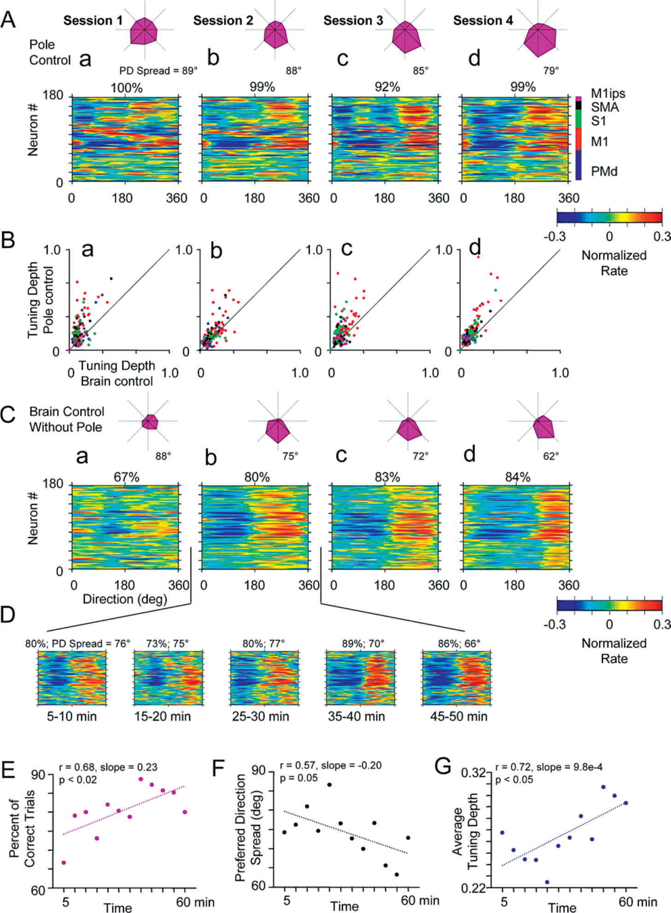
Practice reorganizes the neural population response
Repeated brain-control sessions improved the animal's performance while the relationship between neural activity and direction also changed. Population activity became organized around the directions relevant to the controlled cursor.
Individual neurons contributed differently across practice. These shifts occurred within an ensemble whose output was used by the fixed movement decoder, so changing neuronal patterns altered the commands reaching the device.
The result connected neural plasticity, a change in neural function with experience, to acquisition of an interface skill. Behavioral improvement and population reorganization accompanied learning to control an external output through activity rather than through the previously trained arm movement.
Carmena et al. (2003), Fig. 5. Directional tuning changes with brain-control training.
Carmena et al. (2003)
44
Notes:
• Repeated brain-control sessions improved the animal's performance while the relationship between neural activity and direction also changed. Population activity became organized around the directions relevant to the controlled cursor.
• Individual neurons contributed differently across practice. These shifts occurred within an ensemble whose output was used by the fixed movement decoder, so changing neuronal patterns altered the commands reaching the device.
• The result connected neural plasticity, a change in neural function with experience, to acquisition of an interface skill. Behavioral improvement and population reorganization accompanied learning to control an external output through activity rather than through the previously trained arm movement.
• The reaching and grasping tasks provided separate visual feedback about position and grip. When a robot was included, its measured position and force were represented on the screen. The resulting feedback described what the external actuator actually did, allowing the animal to adjust its neural control.
References:
Carmena JM, Lebedev MA, Crist RE, O'Doherty JE, Santucci DM, Dimitrov DF, Patil PG, Henriquez CS, Nicolelis MAL (2003). Learning to Control a Brain–Machine Interface for Reaching and Grasping by Primates. PLoS Biology 1:e42. https://doi.org/10.1371/journal.pbio.0000042
Figure: Carmena et al. (2003), Fig. 5. Directional tuning changes with brain-control training.
Figure source: https://doi.org/10.1371/journal.pbio.0000042

Slide 45
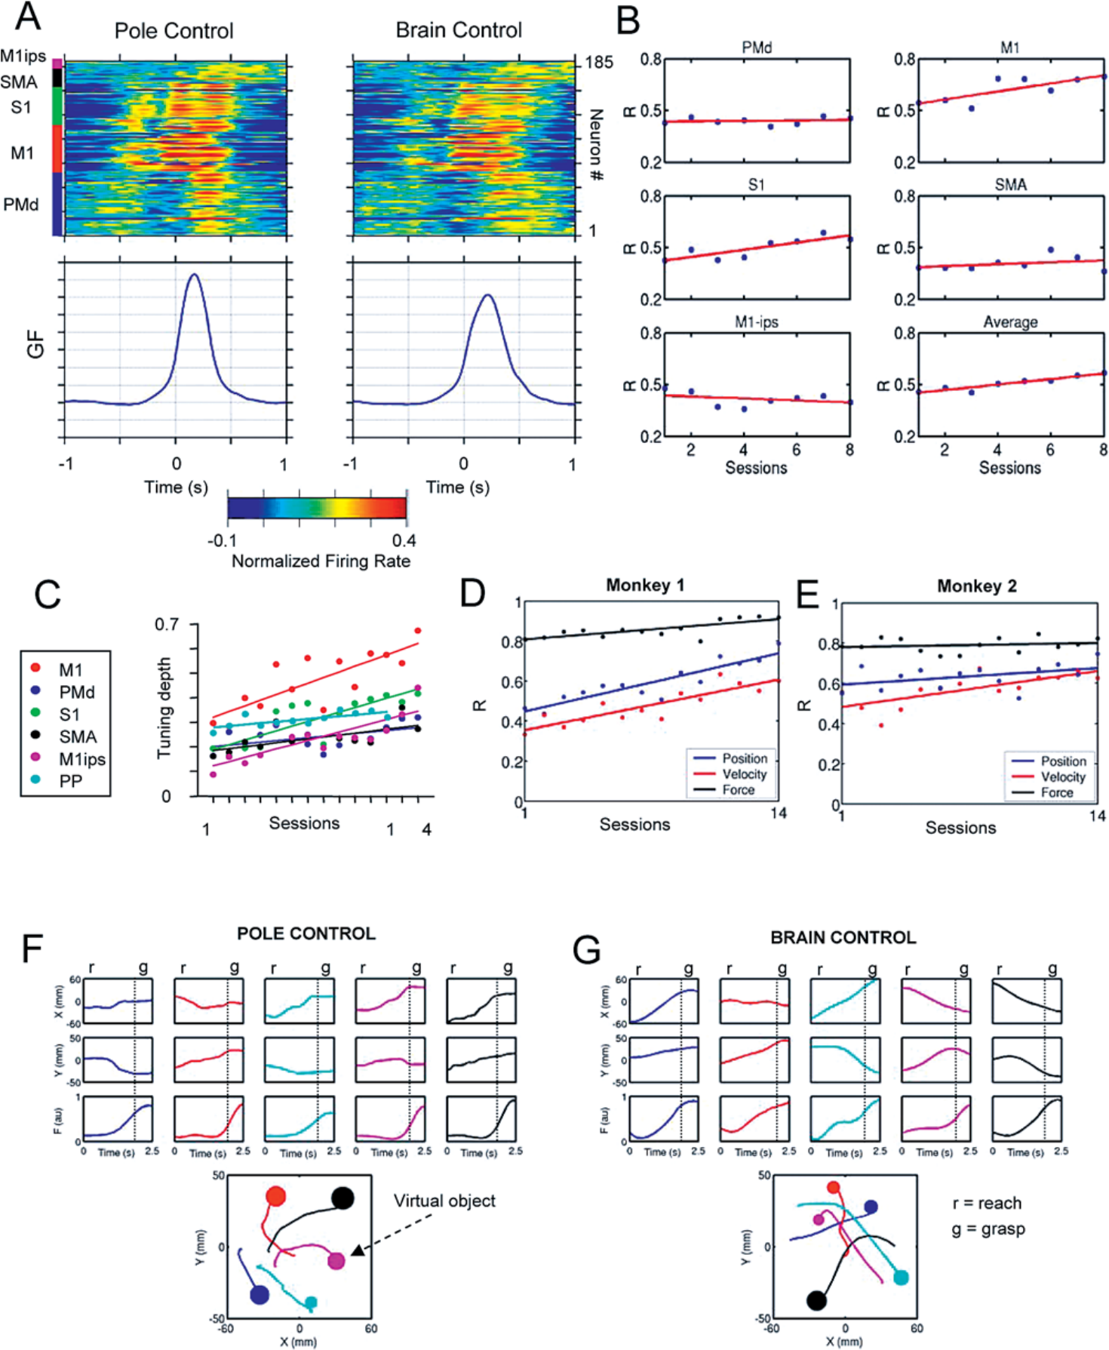
Reaching and gripping require coordinated neural outputs
The combined reach-and-grasp task required moving the cursor to a target and then developing the instructed grip. Cursor position represented reaching, while cursor size conveyed gripping force. Successful performance coordinated these distinct output dimensions.
Carmena and colleagues extracted position and grip information from the same recorded neuronal ensemble. Neural activity around grip onset remained structured during brain control, linking the population response to the task's successive behavioral demands.
Across joystick, touchscreen, vehicle and neural interfaces, reinforcement followed a specific relationship between action and feedback. Changing the controlled output altered the movements or neural patterns needed for success, while repeated practice established a usable mapping to the visible goal.
Carmena et al. (2003), Fig. 6. Neural activity and grip control during virtual grasping.
Carmena et al. (2003)
45
Notes:
• The combined reach-and-grasp task required moving the cursor to a target and then developing the instructed grip. Cursor position represented reaching, while cursor size conveyed gripping force. Successful performance coordinated these distinct output dimensions.
• Carmena and colleagues extracted position and grip information from the same recorded neuronal ensemble. Neural activity around grip onset remained structured during brain control, linking the population response to the task's successive behavioral demands.
• Across joystick, touchscreen, vehicle and neural interfaces, reinforcement followed a specific relationship between action and feedback. Changing the controlled output altered the movements or neural patterns needed for success, while repeated practice established a usable mapping to the visible goal.
• The reaching and grasping tasks provided separate visual feedback about position and grip. When a robot was included, its measured position and force were represented on the screen. The resulting feedback described what the external actuator actually did, allowing the animal to adjust its neural control.
References:
Carmena JM, Lebedev MA, Crist RE, O'Doherty JE, Santucci DM, Dimitrov DF, Patil PG, Henriquez CS, Nicolelis MAL (2003). Learning to Control a Brain–Machine Interface for Reaching and Grasping by Primates. PLoS Biology 1:e42. https://doi.org/10.1371/journal.pbio.0000042
Figure: Carmena et al. (2003), Fig. 6. Neural activity and grip control during virtual grasping.
Figure source: https://doi.org/10.1371/journal.pbio.0000042

Slide 46
Key takeaways
Learned control mappings Animals acquire relationships between their actions, remote visual consequences and reinforcement across joystick, touchscreen and vehicle interfaces.
Species-appropriate interfaces Vision, body size, contact movements and social access determine which actions an interface records and which animals can practice.
Task structure changes behavior Target position, size, movement and response order distinguish spatial selection, precision, timing and sequence learning.
Experience changes acquisition Enriched housing supported rat-driving acquisition and persistence; reinforcement timing changed touchscreen choices.
Transfer and competing responses Pigeons transferred trained portal use to new puzzles; a previously rewarded operation could also attract repeated actions when direct navigation was more effective.
Neural control is plastic Macaques learned cursor and grip control from cortical populations without arm movement; practice changed population tuning and compensation for robot dynamics.
Croney & Boysen (2021); Crawford et al. (2020); Rodrigues et al. (2026); Carmena et al. (2003)
46
Notes:
Croney CC, Boysen ST (2021). Acquisition of a Joystick-Operated Video Task by Pigs (Sus scrofa). Frontiers in Psychology 12:631755. https://doi.org/10.3389/fpsyg.2021.631755
Ao W, Grace M, Floyd CL, Vonder Haar C (2022). A Touchscreen Device for Behavioral Testing in Pigs. Biomedicines 10:2612. https://doi.org/10.3390/biomedicines10102612
Martin CF, Muramatsu A, Matsuzawa T (2022). Apex and ApeTouch: Development of a Portable Touchscreen System and Software for Primates at Zoos. Animals 12:1660. https://doi.org/10.3390/ani12131660
Calapai A, Pfefferle D, Cassidy LC, Nazari A, Yurt P, Brockhausen RR, Treue S (2023). A Touchscreen-Based, Multiple-Choice Approach to Cognitive Enrichment of Captive Rhesus Macaques (Macaca mulatta). Animals 13:2702. https://doi.org/10.3390/ani13172702
Crawford LE, Knouse LE, Kent M, Vavra D, Harding O, LeServe D, Fox N, Hu X, Li P, Glory C, Lambert KG (2020). Enriched environment exposure accelerates rodent driving skills. Behavioural Brain Research 378:112309. https://doi.org/10.1016/j.bbr.2019.112309
Carmena JM, Lebedev MA, Crist RE, O'Doherty JE, Santucci DM, Dimitrov DF, Patil PG, Henriquez CS, Nicolelis MAL (2003). Learning to Control a Brain–Machine Interface for Reaching and Grasping by Primates. PLoS Biology 1:e42. https://doi.org/10.1371/journal.pbio.0000042
Rodrigues RS, Kirkman C, Garcia‐Mijares M, Blaisdell AP (2026). Pigeons, portals, and Pacman: Insightful problem solving and navigation using a touchscreen video game. Journal of the Experimental Analysis of Behavior 125:e70083. https://doi.org/10.1002/jeab.70083

