Slide 1

NEUR 411 · NEUROETHOLOGY · FALL 2026 · Lecture 19
Owl sound localization II: developmental plasticity of the auditory map
Wednesday, October 7, 2026
Jordan Lopez, Ph.D.
Photo: Barn owl (Tyto alba). Michael Gäbler, CC BY 3.0.
Notes:
Owl sound localization II: developmental plasticity of the auditory map
Wednesday, October 7, 2026
Photo: Barn owl (Tyto alba). Michael Gäbler, CC BY 3.0.
Credit: Michael Gäbler / Wikimedia Commons
License: CC BY 3.0
Source: https://commons.wikimedia.org/wiki/File:Tyto_alba_(Scopoli,_1769).jpg

Slide 2
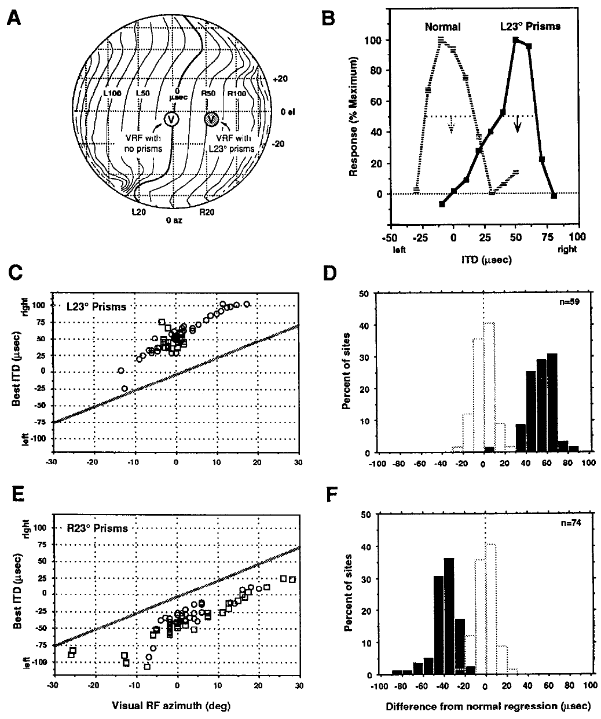
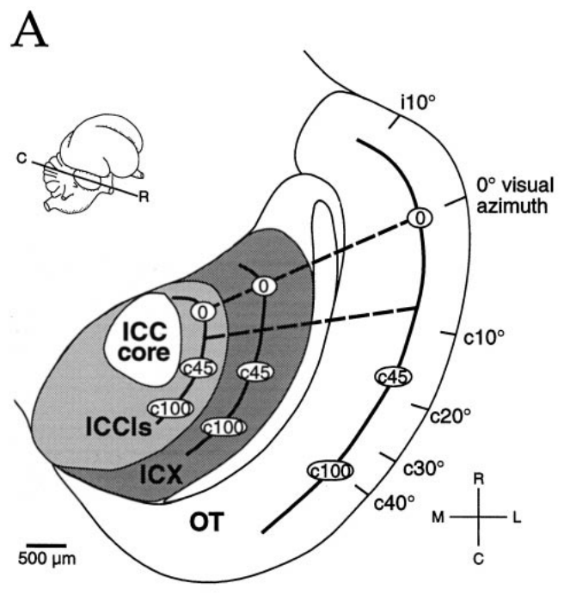
Visual experience recalibrates auditory space
A neural map is an ordered representation in which neighboring tissue locations stand for neighboring places in space. In the barn owl, the optic tectum holds an auditory map and a visual map that normally assign a sound and a visible object to the same location. That shared arrangement is the baseline these experiments alter.
Brainard and Knudsen raised juvenile owls with prisms that displaced vision 23° horizontally. Their auditory neurons came to prefer timing values suited to the displaced visual field. Visual receptive fields were then measured without prisms, which fixed the normal anatomical reference for each recording site in the tectum. The neurons changed which timing values they preferred most.
The adaptation changed how acoustic cues corresponded to represented space. Sound sources did not need to move, and sounds did not need to pass through the prisms. The change is sensory calibration rather than a direct optical effect on the sound itself, and the correspondence between cue and location shifted. The measured correspondence is checked again at each site.
Feldman & Knudsen (1998), Fig. 2(A). ICCls, ICX, and optic-tectum locations.
Brainard & Knudsen (1993)
2
Notes:
Teaching transcript:
A neural map is an ordered representation in which neighboring locations in tissue represent neighboring stimulus locations. In the barn owl, Tyto alba, the optic tectum contains auditory and visual maps that normally assign the same location to a sound and a visible object.
Brainard and Knudsen raised juvenile owls with prisms that displaced vision by 23° horizontally. Neurons acquired auditory timing preferences appropriate for the displaced visual field. Their visual receptive fields were measured without the prisms to establish the normal anatomical reference.
The adaptation changed the correspondence between auditory cues and represented space. It did not require sound sources to move or auditory signals to pass through the prisms. The measured change is sensory calibration rather than a direct optical effect on sound.
A receptive field is the stimulus region that drives a neuron. The prismatic displacement changes the visual reference used to associate an auditory cue with a location.
References:
MS Brainard; EI Knudsen (1993). Experience-dependent plasticity in the inferior colliculus: a site for visual calibration of the neural representation of auditory space in the barn owl. The Journal of Neuroscience 13(11):4589-4608. https://doi.org/10.1523/jneurosci.13-11-04589.1993
Daniel E. Feldman; Eric I. Knudsen (1998). Pharmacological Specialization of Learned Auditory Responses in the Inferior Colliculus of the Barn Owl. The Journal of Neuroscience 18(8):3073-3087. https://doi.org/10.1523/jneurosci.18-08-03073.1998
Brainard & Knudsen (1993), Fig. 5. Prism rearing shifts tectal ITD tuning.
Figure source: https://doi.org/10.1523/jneurosci.13-11-04589.1993
Feldman & Knudsen (1998), Fig. 2(A). ICCls, ICX, and optic-tectum locations.
Figure source: https://doi.org/10.1523/jneurosci.18-08-03073.1998

Slide 3
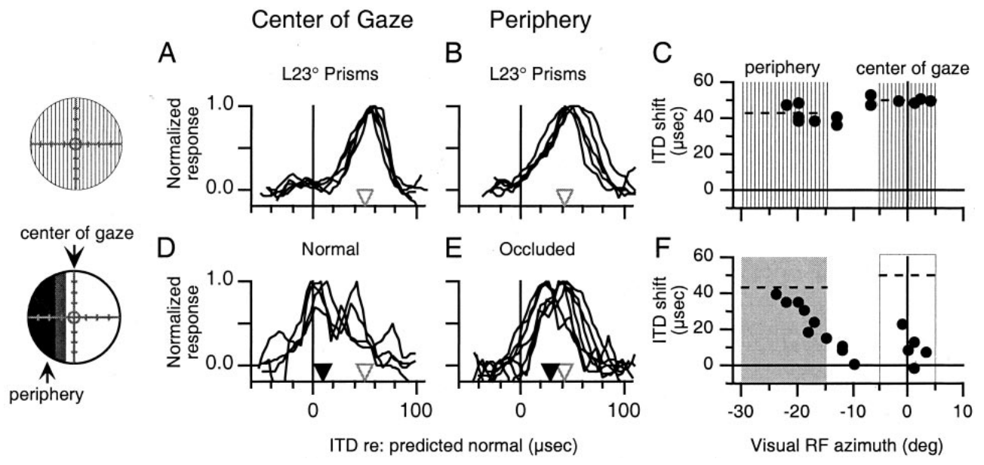
Prisms change the visual reference for sound
Prisms refract light, so a visible object appears displaced while its sound stays where it was. That mismatch between vision and hearing is the stimulus that drives adaptation in these experiments. The displacement works through refraction alone, with the sound left untouched by the optics. Light refraction therefore shifts the apparent direction of a visual target object.
Hyde and Knudsen used 23° prisms, then altered vision separately in central and peripheral regions of the visual field. Each manipulation changed one visual region at a time. The resulting auditory adjustments depended on which part of visual space remained available to the animal. The regional result shows that the visual source of each adjustment matters.
These manipulations identify the visual information that guides calibration. Regional visual input appears to set the adjustment of each part of the map, which points toward location-specific instruction. The regional pattern means each location in the auditory map answers to its own visual input. Each part of the map therefore answers to visual input from its own region.
Hyde & Knudsen (2001), Fig. 1(A–F). Regional visual manipulations and auditory tuning.
Feldman & Knudsen (1998), Fig. 2(A). ICCls, ICX, and optic-tectum locations.
Hyde & Knudsen (2001)
3
Notes:
Teaching transcript:
A prism refracts light, displacing the apparent direction of an object while leaving its sound unchanged. A visual receptive field, or VRF, identifies the position in visual space that activates a neuron. Comparing auditory tuning with that field separates altered sensory registration from the location of the recording site.
Hyde and Knudsen used 23° prisms and then altered vision separately in central and peripheral regions. The resulting auditory adjustments depended on which part of visual space remained available. A single direction of displacement did not force every portion of the auditory map to change equally.
These manipulations test the information that guides calibration. They do not measure a visual teaching synapse directly, and they do not establish that visual and auditory inputs are compared by one particular neuron.
Occlusion removes regional visual information; it differs from an optical displacement that preserves visible objects while moving their apparent positions.
References:
Peter S. Hyde; Eric I. Knudsen (2001). A Topographic Instructive Signal Guides the Adjustment of the Auditory Space Map in the Optic Tectum. The Journal of Neuroscience 21(21):8586-8593. https://doi.org/10.1523/jneurosci.21-21-08586.2001
Daniel E. Feldman; Eric I. Knudsen (1998). Pharmacological Specialization of Learned Auditory Responses in the Inferior Colliculus of the Barn Owl. The Journal of Neuroscience 18(8):3073-3087. https://doi.org/10.1523/jneurosci.18-08-03073.1998
Hyde & Knudsen (2001), Fig. 1(A–F). Regional visual manipulations and auditory tuning.
Figure source: https://doi.org/10.1523/jneurosci.21-21-08586.2001
Feldman & Knudsen (1998), Fig. 2(A). ICCls, ICX, and optic-tectum locations.
Figure source: https://doi.org/10.1523/jneurosci.18-08-03073.1998

Slide 4
Occlusion and displacement differ in input
A visual receptive field, or VRF, is the region of visual space whose stimulation drives a neuron. Auditory tuning recorded at the same site can be read against that VRF, which shows where a given timing preference points in space. Each site thus links a timing value to a point in the visual field, and the prismatic displacement changes that visual reference.
Occluding part of the visual field removes regional visual information, leaving that region without any input. An optical displacement works differently, because visible objects remain present while their apparent positions move. The two manipulations probe different aspects of the visual input and can yield different auditory outcomes.
In one owl, the visual field beyond 15° was occluded while the central field stayed normal. That arrangement kept normal vision at the center of gaze and left the periphery without visual input. Regions with different visual status within one animal give an internal control for the calibration.
Hyde & Knudsen (2001), Fig. 1(A–F). Regional visual manipulations and auditory tuning.
Feldman & Knudsen (1998), Fig. 2(A). ICCls, ICX, and optic-tectum locations.
Hyde & Knudsen (2001)
3a
Notes:
Occlusion and displacement differ in input.
Explanation 1.
A visual receptive field, or VRF, is the region of visual space whose stimulation drives a neuron
Auditory tuning recorded at the same site can be read against that VRF, which shows where a given timing preference points in space. Each site thus links a timing value to a point in the visual field, and the prismatic displacement changes that visual reference.
Explanation 2.
Occluding part of the visual field removes regional visual information, leaving that region without any input
An optical displacement works differently, because visible objects remain present while their apparent positions move. The two manipulations probe different aspects of the visual input and can yield different auditory outcomes.
Explanation 3.
In one owl, the visual field beyond 15° was occluded while the central field stayed normal
That arrangement kept normal vision at the center of gaze and left the periphery without visual input. Regions with different visual status within one animal give an internal control for the calibration.
Source.
The figure and its data come from Hyde & Knudsen (2001).
The full references are listed below.
References:
Peter S. Hyde; Eric I. Knudsen (2001). A Topographic Instructive Signal Guides the Adjustment of the Auditory Space Map in the Optic Tectum. The Journal of Neuroscience 21(21):8586-8593. https://doi.org/10.1523/jneurosci.21-21-08586.2001

Slide 5
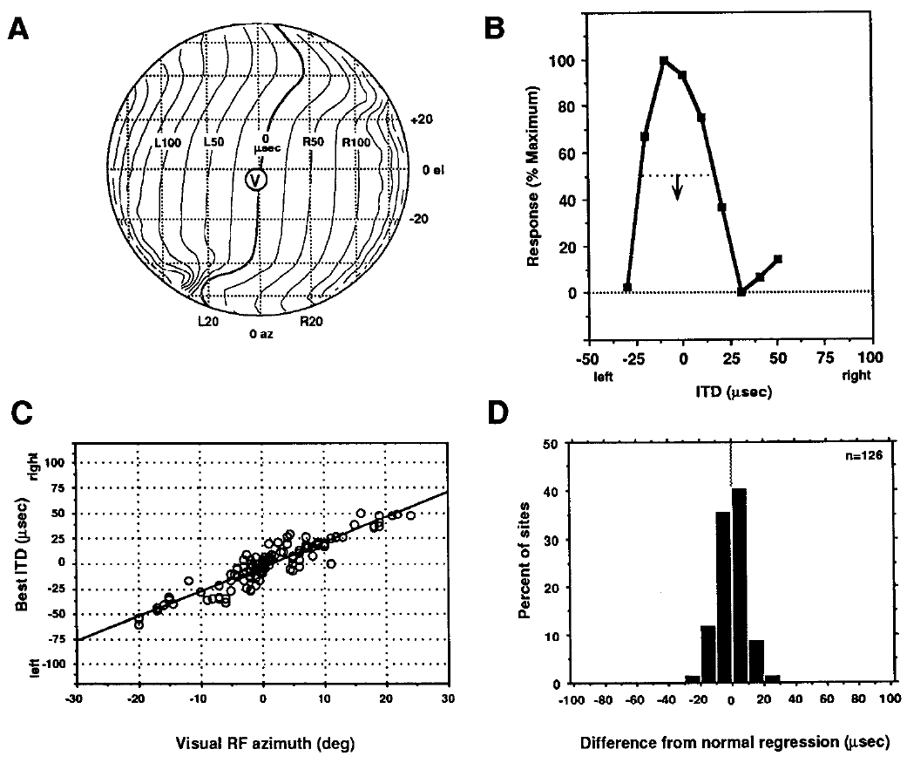
Microsecond timing is assigned to a spatial location
Interaural time difference, or ITD, is the difference in arrival time of a sound at the two ears. Timing differences are measured in microseconds, while horizontal direction, or azimuth, is measured in degrees, so the two quantities use different units and scales. Those two quantities use different scales, so the timing cue and the perceived direction must be related through the map.
Brainard and Knudsen recorded best ITDs and visual receptive-field positions at tectal sites. In normal owls, the preferred timing changed systematically with visual azimuth. A best ITD is the timing value that produces the strongest response in a tuning curve, not the only value able to activate the neuron. That value indexes preferred timing at each site.
The normal relationship between visual position and timing serves as a reference for measuring prism-induced shifts. A prism changes which timing value is appropriate for a mapped location, while the physical ITD delivered to the ears keeps its original meaning. That normal relationship is a benchmark for judging each shifted site. Shifted sites are judged against it.
Brainard & Knudsen (1993), Fig. 3. Normal relationships among visual position and ITD.
Feldman & Knudsen (1998), Fig. 2(A). ICCls, ICX, and optic-tectum locations.
Brainard & Knudsen (1993)
4
Notes:
Teaching transcript:
Interaural time difference, or ITD, is the difference in arrival time of a sound at the two ears. Ear-leading labels indicate which ear receives the waveform first. In these experiments, timing differences are measured in microseconds, whereas the perceived horizontal direction, or azimuth, is measured in degrees.
Brainard and Knudsen measured best ITDs and visual receptive-field positions at tectal sites. In normal owls, preferred timing changed systematically with visual azimuth. Best ITD means the timing difference producing the strongest response in a tuning curve, rather than the only timing value that can activate the neuron.
The relationship supplies a reference for assessing prism-induced shifts. Optical displacement changes which timing value is appropriate for a mapped location; it does not change the meaning of the physical ITD delivered to the ears.
A tuning curve records neuronal response across stimulus values. Its preferred value and its width describe different properties of the response.
References:
MS Brainard; EI Knudsen (1993). Experience-dependent plasticity in the inferior colliculus: a site for visual calibration of the neural representation of auditory space in the barn owl. The Journal of Neuroscience 13(11):4589-4608. https://doi.org/10.1523/jneurosci.13-11-04589.1993
Daniel E. Feldman; Eric I. Knudsen (1998). Pharmacological Specialization of Learned Auditory Responses in the Inferior Colliculus of the Barn Owl. The Journal of Neuroscience 18(8):3073-3087. https://doi.org/10.1523/jneurosci.18-08-03073.1998
Brainard & Knudsen (1993), Fig. 3. Normal relationships among visual position and ITD.
Figure source: https://doi.org/10.1523/jneurosci.13-11-04589.1993
Feldman & Knudsen (1998), Fig. 2(A). ICCls, ICX, and optic-tectum locations.
Figure source: https://doi.org/10.1523/jneurosci.18-08-03073.1998

Slide 6
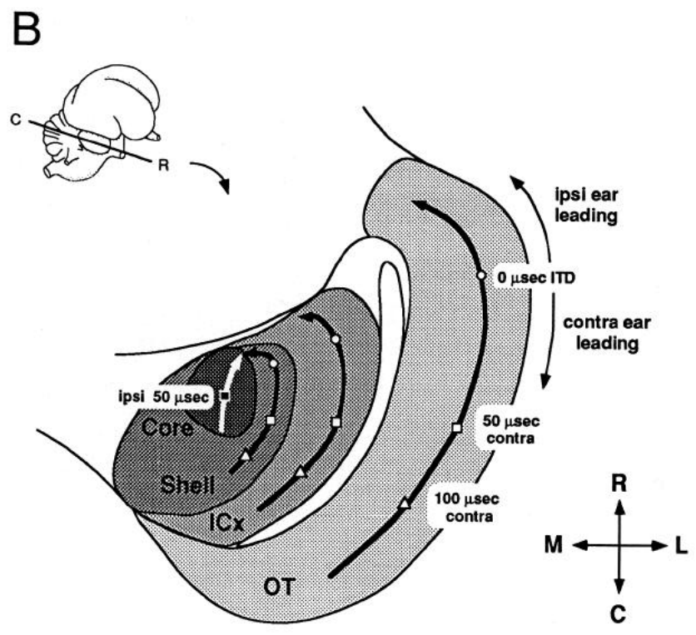
The external colliculus constructs a space map
The inferior colliculus is a midbrain auditory structure. Its central nucleus, ICC, holds frequency-organized auditory representations, and its external nucleus, ICX, pools information across frequency channels. ICX then supplies a spatially ordered auditory representation to the optic tectum. Frequency organization is a property of ICC, not of ICX. The spatial map therefore arises downstream of that organization.
Brainard and Knudsen identified recording locations with anatomical reconstructions and with response properties. The lateral shell of the central nucleus and the external nucleus occupy different parts of one midbrain complex. Adaptation could therefore alter their auditory responses in different ways. Each recording site thus has an anatomical address. The sites were located in the histological sections.
After a 23° visual displacement, timing preferences shifted downstream in ICX, while upstream timing representations stayed normal. Physical proximity did not guarantee identical plasticity. The major adaptive change lies in the transformation from the central to the external collicular representation. The change is local to that transformation. The distinction is clear.
Brainard & Knudsen (1993), Fig. 1(B). Anatomical locations of the auditory midbrain nuclei.
Brainard & Knudsen (1993)
5
Notes:
Teaching transcript:
The inferior colliculus is a midbrain auditory structure. Its central nucleus, ICC, contains frequency-organized auditory representations. The external nucleus, ICX, combines information across frequency channels and supplies a spatially ordered auditory representation to the optic tectum.
Brainard and Knudsen distinguished recording locations using anatomical reconstructions and response properties. The lateral shell of the central nucleus and the external nucleus occupy different parts of the same midbrain complex. That distinction is necessary because prism adaptation could alter their auditory responses differently.
A 23° visual displacement shifted timing preferences downstream in ICX while upstream timing representations remained normal. Anatomical proximity therefore did not imply identical plasticity. The physiological comparison localized a major adaptive change to the transformation between the central and external collicular representations.
Topographic projections preserve an ordered relationship between source and target locations. Such projections connect the ICX spatial representation with the tectal map.
References:
MS Brainard; EI Knudsen (1993). Experience-dependent plasticity in the inferior colliculus: a site for visual calibration of the neural representation of auditory space in the barn owl. The Journal of Neuroscience 13(11):4589-4608. https://doi.org/10.1523/jneurosci.13-11-04589.1993
Brainard & Knudsen (1993), Fig. 1(B). Anatomical locations of the auditory midbrain nuclei.
Figure source: https://doi.org/10.1523/jneurosci.13-11-04589.1993

Slide 7
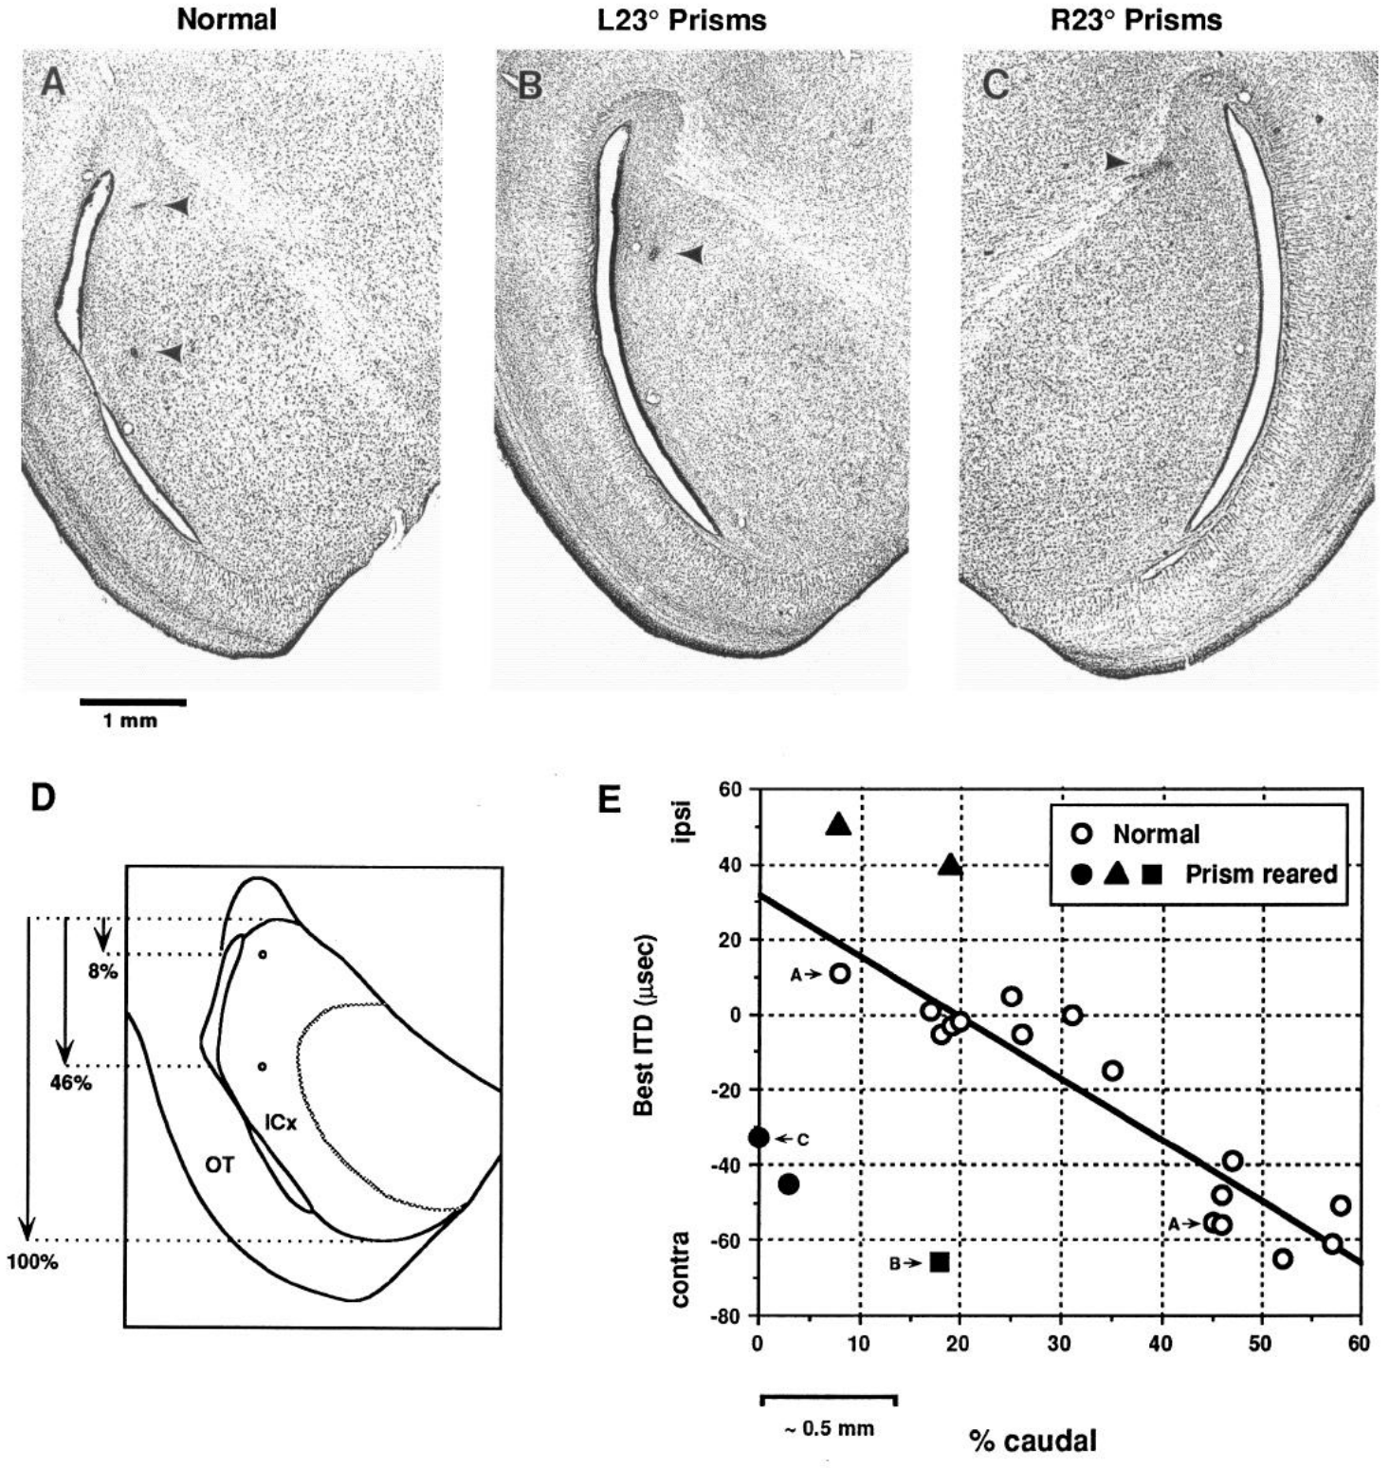
Adaptive timing shifts are already present in ICX
Brainard and Knudsen compared the best ITD of each recording with its position inside ICX. Histological sections located those recording sites, so every timing value could be read against a defined place in the nucleus. Best ITD values could then be compared across the anatomical extent of ICX. The nucleus is divided into measured positions.
Owls reared with leftward and rightward 23° displacements acquired timing preferences that shifted in opposite adaptive directions. The shifts were already present in ICX, before its output reached the optic tectum. Normal animals supplied the reference that links each location to its expected best ITD. The opposite shifts show that the prism direction determines the direction of adaptation in ICX.
Finding the adaptive shift in ICX identifies that nucleus as a site of expressed plasticity. Functional localization and cellular mechanism are separate questions, and each requires its own kind of evidence. Anatomical coordinates constrain how the physiological shift is interpreted. Functional localization identifies where the change appears, while mechanism asks how the change is produced.
Brainard & Knudsen (1993), Fig. 13(A–E). Histological recording sites and ICX ITD preferences.
Brainard & Knudsen (1993)
6
Notes:
Teaching transcript:
Brainard and Knudsen marked recording sites in histological sections and compared best ITD with position within ICX. Histology identifies tissue structures in thin stained sections. Electrode-site lesions linked each measured response to an anatomical location rather than relying only on the shape of its tuning curve.
Owls reared with leftward and rightward 23° displacements acquired timing preferences shifted in opposite adaptive directions. The shifts were present in ICX, before its output reached the optic tectum. Normal animals supplied the comparison between location and expected best ITD.
The experiment identifies ICX as a site expressing adaptive plasticity. It does not exclude additional plasticity elsewhere, and it does not by itself identify which excitatory synapses or inhibitory connections changed. Functional localization and cellular mechanism require different evidence.
The one-millimeter scale bar belongs to the original histological figure. Anatomical coordinates constrain the interpretation of the physiological shift.
References:
MS Brainard; EI Knudsen (1993). Experience-dependent plasticity in the inferior colliculus: a site for visual calibration of the neural representation of auditory space in the barn owl. The Journal of Neuroscience 13(11):4589-4608. https://doi.org/10.1523/jneurosci.13-11-04589.1993
Brainard & Knudsen (1993), Fig. 13(A–E). Histological recording sites and ICX ITD preferences.
Figure source: https://doi.org/10.1523/jneurosci.13-11-04589.1993

Slide 8
Electrode lesions anchor timing to tissue
Ear-leading labels state which ear receives the waveform first, so each timing value carries a sign as well as a magnitude. Leftward and rightward displacements produce timing values that differ in sign. Reading the sign of each measured value is what allows the direction of an adaptive shift to be identified.
Electrode-site lesions linked each measured response to a specific anatomical location. Histology identifies tissue structures in thin stained sections, so a response could be assigned to tissue rather than judged from the shape of its tuning curve alone. Lesions marked at recording sites provided the anatomical reference for that assignment.
Topographic projections preserve an ordered relationship between source and target locations. Such projections connect the ICX spatial representation with the tectal map. An ordered location in ICX can be followed to a corresponding position in the optic tectum. Ordered projections preserve neighboring relations, so neighboring ICX locations project to neighboring tectal locations.
Brainard & Knudsen (1993), Fig. 13(A–E). Histological recording sites and ICX ITD preferences.
Brainard & Knudsen (1993)
6a
Notes:
Electrode lesions anchor timing to tissue.
Explanation 1.
Ear-leading labels state which ear receives the waveform first, so each timing value carries a sign as well as a magnitude
Leftward and rightward displacements produce timing values that differ in sign. Reading the sign of each measured value is what allows the direction of an adaptive shift to be identified.
Explanation 2.
Electrode-site lesions linked each measured response to a specific anatomical location
Histology identifies tissue structures in thin stained sections, so a response could be assigned to tissue rather than judged from the shape of its tuning curve alone. Lesions marked at recording sites provided the anatomical reference for that assignment.
Explanation 3.
Topographic projections preserve an ordered relationship between source and target locations
Such projections connect the ICX spatial representation with the tectal map. An ordered location in ICX can be followed to a corresponding position in the optic tectum. Ordered projections preserve neighboring relations, so neighboring ICX locations project to neighboring tectal locations.
Source.
The figure and its data come from Brainard & Knudsen (1993).
The full references are listed below.
References:
MS Brainard; EI Knudsen (1993). Experience-dependent plasticity in the inferior colliculus: a site for visual calibration of the neural representation of auditory space in the barn owl. The Journal of Neuroscience 13(11):4589-4608. https://doi.org/10.1523/jneurosci.13-11-04589.1993

Slide 9
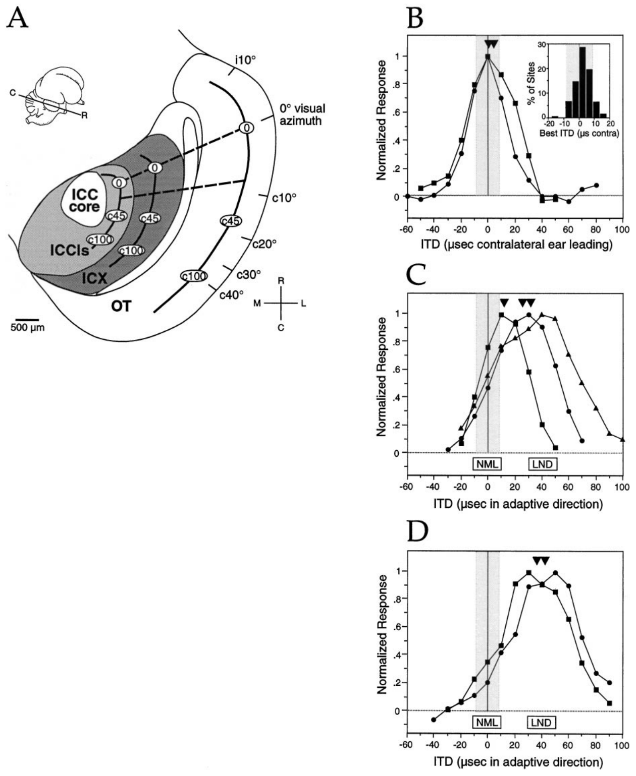
Learned and normal responses can coexist
During adaptation, ICX neurons can respond to both their original timing range and newly acquired timing values. Feldman and Knudsen called this transition-state tuning. A broad or double-peaked curve can therefore reflect normal and learned responses coexisting, rather than one intermediate response to a single timing value. Transition-state tuning has two response components, and both remain measurable.
The authors recorded along anatomical transects that normally represent the same ITD. After 20–60 days of prism experience, units often kept a normal component while expressing an added adaptive component. Longer prism experience produced more strongly shifted tuning at many sites, so the adaptive component grew with exposure. Anatomical transects link recordings at sites that normally share the same ITD.
Both components occupy the same tissue, so a drug can act on normal and learned responses at one recording site. A single recording can therefore carry both response components at once, so the drug test stays at one site. The double-peaked shape shows the coexistence directly, with the normal peak still measurable.
Feldman & Knudsen (1998), Fig. 2(A–D). Anatomical transects and transition-state tuning.
Feldman & Knudsen (1998)
7
Notes:
Teaching transcript:
During adaptation, ICX neurons can respond to both their original timing range and newly acquired timing values. Feldman and Knudsen called this transition-state tuning. A broad or double-peaked curve can therefore represent coexistence of normal and learned responses rather than an intermediate response to one timing value.
The authors compared recordings along anatomical transects that normally represented the same ITD. After 20–60 days of prism experience, units often retained a normal component while expressing an additional adaptive component. Longer prism experience produced more strongly shifted tuning at many sites.
The coexistence allowed pharmacological comparisons within a single recording. A drug could be tested against normal and learned responses in the same tissue, reducing the ambiguity associated with comparing unrelated neurons or regions.
An iso-ITD transect is a recording trajectory joining locations that normally share the same preferred interaural timing difference.
References:
Daniel E. Feldman; Eric I. Knudsen (1998). Pharmacological Specialization of Learned Auditory Responses in the Inferior Colliculus of the Barn Owl. The Journal of Neuroscience 18(8):3073-3087. https://doi.org/10.1523/jneurosci.18-08-03073.1998
Feldman & Knudsen (1998), Fig. 2(A–D). Anatomical transects and transition-state tuning.
Figure source: https://doi.org/10.1523/jneurosci.18-08-03073.1998

Slide 10
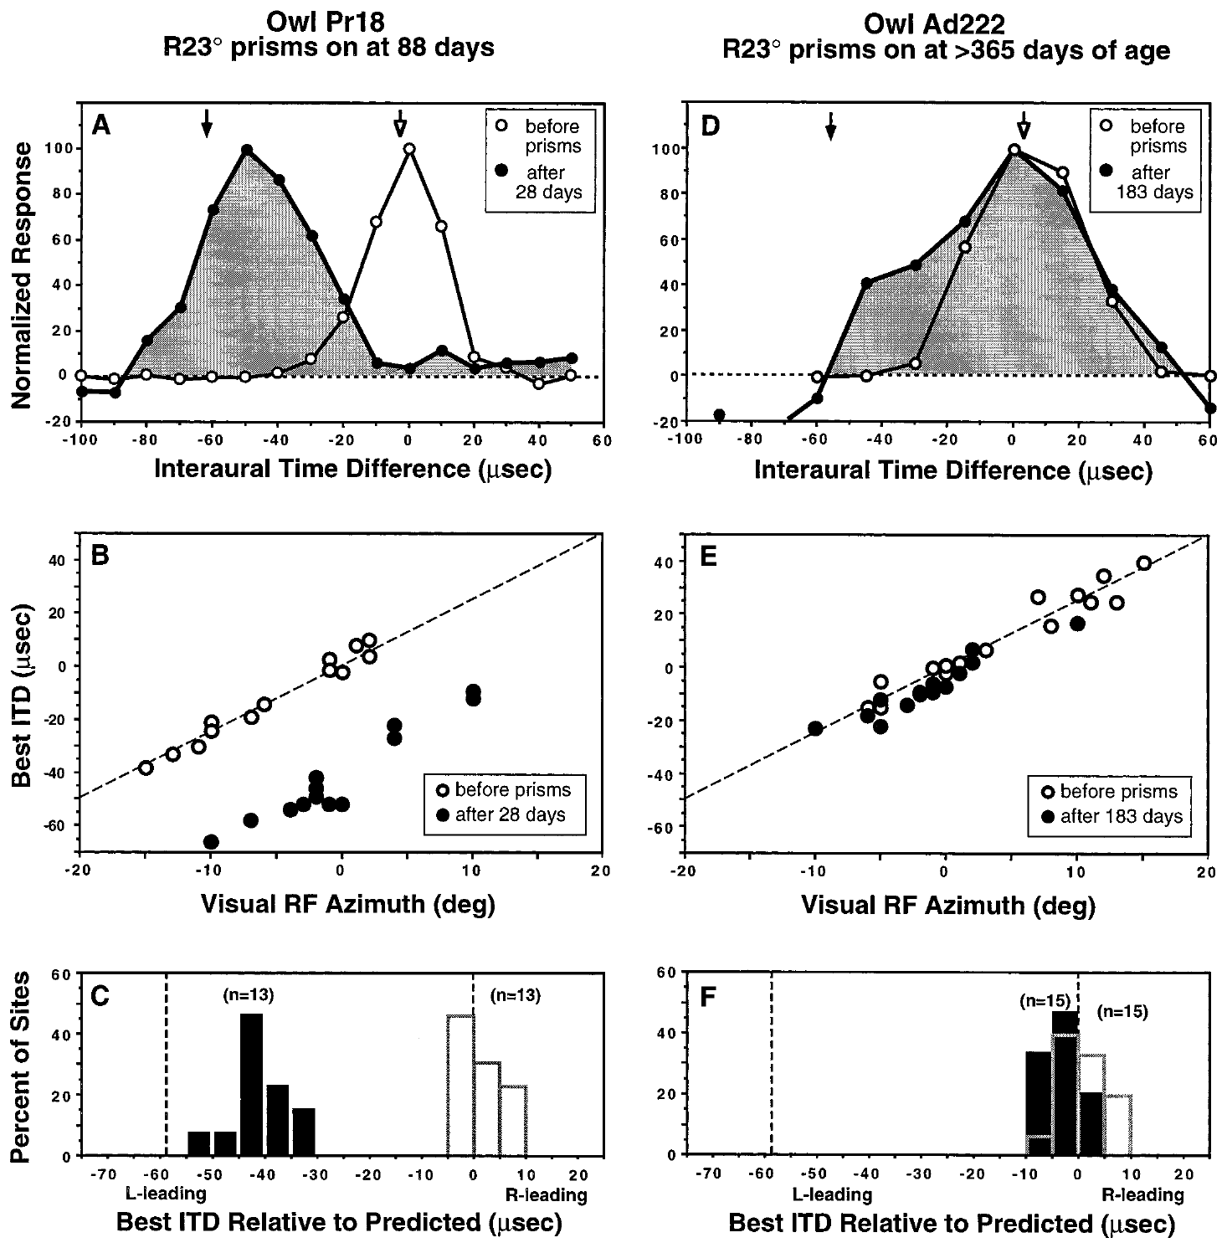
The same visual displacement has age-dependent effects
A sensitive period is an age range during which a particular experience can alter a circuit especially strongly. Brainard and Knudsen compared the response to 23° prisms in juvenile and adult barn owls by measuring preferred ITDs against visual receptive-field locations. The juvenile and adult comparison used the same measure. Both juveniles and adults were tested.
An owl fitted with prisms at 88 days of age showed a substantial adaptive shift after 28 days of prism experience. An adult fitted after one year of age changed much less, even after 183 days. Both animals faced the same kind of sensory mismatch and were measured with the same neural response measure.
Longer exposure therefore did not compensate automatically for older age. These results support developmental regulation of auditory-map plasticity, and prior experience and the environment are candidate modifiers of that regulation. The age difference, rather than the total exposure, is the variable that changed the outcome. Days of exposure therefore fail to account for the whole difference.
Brainard & Knudsen (1998), Fig. 1(A–F). Juvenile and adult tuning before and after prisms.
Feldman & Knudsen (1998), Fig. 2(A). ICCls, ICX, and optic-tectum locations.
Brainard & Knudsen (1998)
8
Notes:
Teaching transcript:
A sensitive period is an age range during which a particular experience can alter a circuit especially strongly. Brainard and Knudsen compared the response to 23° prisms in juvenile and adult barn owls, measuring preferred ITDs against visual receptive-field locations.
An owl fitted at 88 days of age showed a substantial adaptive shift after 28 days of prism experience. An adult fitted after one year of age exhibited much less change even after 183 days. The difference concerned the same kind of sensory mismatch and the same neural response measure.
Longer exposure therefore did not automatically compensate for older age. The comparison supports developmental regulation of auditory-map plasticity, while leaving open how prior experience and the environment influence that regulation.
The relevant outcome is the displacement of auditory preference relative to the normal visual reference, rather than the total number of days wearing spectacles.
References:
Michael S. Brainard; Eric I. Knudsen (1998). Sensitive Periods for Visual Calibration of the Auditory Space Map in the Barn Owl Optic Tectum. The Journal of Neuroscience 18(10):3929-3942. https://doi.org/10.1523/jneurosci.18-10-03929.1998
Daniel E. Feldman; Eric I. Knudsen (1998). Pharmacological Specialization of Learned Auditory Responses in the Inferior Colliculus of the Barn Owl. The Journal of Neuroscience 18(8):3073-3087. https://doi.org/10.1523/jneurosci.18-08-03073.1998
Brainard & Knudsen (1998), Fig. 1(A–F). Juvenile and adult tuning before and after prisms.
Figure source: https://doi.org/10.1523/jneurosci.18-10-03929.1998
Feldman & Knudsen (1998), Fig. 2(A). ICCls, ICX, and optic-tectum locations.
Figure source: https://doi.org/10.1523/jneurosci.18-08-03073.1998

Slide 11
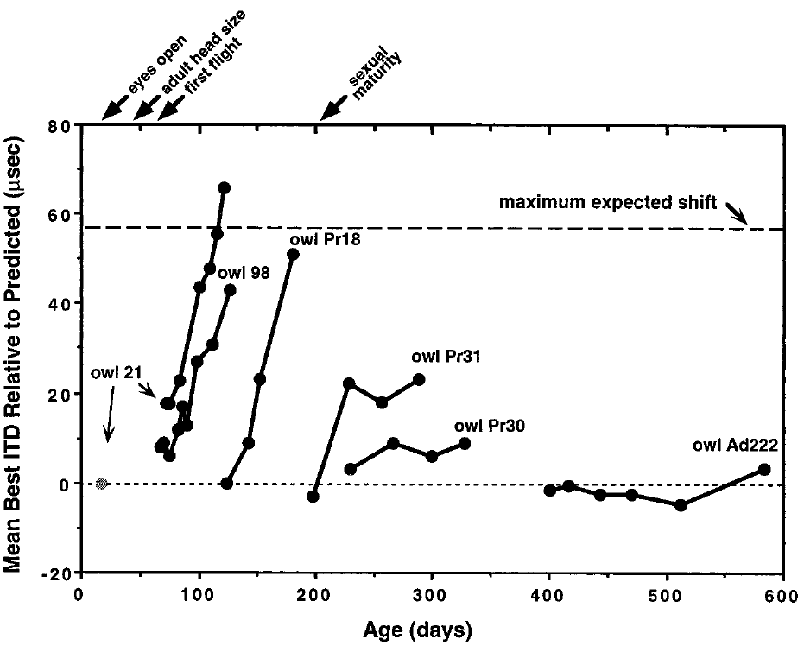
Map adjustment develops over repeated experience
Repeated recordings distinguish a stable preexisting map from a map that changes during experience. Brainard and Knudsen followed tectal timing preferences with chronic electrodes, or by sampling several sites across successive sessions after the prisms were attached. These approaches track the time course of adjustment across sessions. Both methods record the same population of tectal sites.
With 23° prisms, the expected full adaptive change was about 57 µs. Younger owls moved toward that value over days and weeks, whereas older owls often stayed near the normal reference. Time courses varied across ages and individuals instead of following one universal rate. Repeated sessions made the sequence of change visible for each animal.
Repeated sampling of a population tracks changes in the population's best ITD. Each recording sums the activity of many inputs into one timing value. Averages over many inputs can hide the contribution of any single input. Such changes can arise from altered weighting of several inputs. They are population measures, not single-synapse measures.
Brainard & Knudsen (1998), Fig. 2. Time courses of preferred-ITD adjustment.
Feldman & Knudsen (1998), Fig. 2(A). ICCls, ICX, and optic-tectum locations.
Brainard & Knudsen (1998)
9
Notes:
Teaching transcript:
Repeated recordings distinguish a stable preexisting map from a map that changes during experience. Brainard and Knudsen followed tectal timing preferences with chronic electrodes or by sampling multiple sites across successive sessions after prisms were attached.
With 23° prisms, the expected full adaptive change was approximately 57 µs. Younger owls progressed toward that value over days and weeks, whereas older owls often remained near the normal reference. The time courses differed across ages and individuals rather than following one universal rate.
Chronic recording means returning to a recording preparation over time. These measurements establish the temporal course of functional adaptation, but repeated population sampling does not track the same synapse. A changing best ITD can result from altered weighting of several inputs.
A complete adaptive shift is a reference predicted from the visual displacement. It is not an assumption that every animal must reach the same endpoint.
References:
Michael S. Brainard; Eric I. Knudsen (1998). Sensitive Periods for Visual Calibration of the Auditory Space Map in the Barn Owl Optic Tectum. The Journal of Neuroscience 18(10):3929-3942. https://doi.org/10.1523/jneurosci.18-10-03929.1998
Daniel E. Feldman; Eric I. Knudsen (1998). Pharmacological Specialization of Learned Auditory Responses in the Inferior Colliculus of the Barn Owl. The Journal of Neuroscience 18(8):3073-3087. https://doi.org/10.1523/jneurosci.18-08-03073.1998
Brainard & Knudsen (1998), Fig. 2. Time courses of preferred-ITD adjustment.
Figure source: https://doi.org/10.1523/jneurosci.18-10-03929.1998
Feldman & Knudsen (1998), Fig. 2(A). ICCls, ICX, and optic-tectum locations.
Figure source: https://doi.org/10.1523/jneurosci.18-08-03073.1998

Slide 12
Shift size is set by the visual reference
A complete adaptive shift is a reference predicted from the visual displacement. It is an expectation for the animal's map, not an assumption that every animal must reach the same endpoint. Owls differ in how far their maps move, so the predicted shift works as a benchmark rather than a fixed outcome.
The outcome in this work is how far the auditory preference sits from the normal visual reference. The count of days spent in prisms is a distinct measure and is not a substitute for displacement. Displacement relative to that reference expresses the adaptation of each owl.
Chronic recording means returning to the same preparation across time. Repeated measurements of this kind establish the temporal course of functional adaptation, which one session alone would not reveal. Each animal's time course can then be set against the predicted endpoint. Stable and changing maps can be told apart by repeated sessions.
Brainard & Knudsen (1998), Fig. 2. Time courses of preferred-ITD adjustment.
Feldman & Knudsen (1998), Fig. 2(A). ICCls, ICX, and optic-tectum locations.
Brainard & Knudsen (1998)
9a
Notes:
Shift size is set by the visual reference.
Explanation 1.
A complete adaptive shift is a reference predicted from the visual displacement
It is an expectation for the animal's map, not an assumption that every animal must reach the same endpoint. Owls differ in how far their maps move, so the predicted shift works as a benchmark rather than a fixed outcome.
Explanation 2.
The outcome in this work is how far the auditory preference sits from the normal visual reference
The count of days spent in prisms is a distinct measure and is not a substitute for displacement. Displacement relative to that reference expresses the adaptation of each owl.
Explanation 3.
Chronic recording means returning to the same preparation across time
Repeated measurements of this kind establish the temporal course of functional adaptation, which one session alone would not reveal. Each animal's time course can then be set against the predicted endpoint. Stable and changing maps can be told apart by repeated sessions.
Source.
The figure and its data come from Brainard & Knudsen (1998).
The full references are listed below.
References:
Michael S. Brainard; Eric I. Knudsen (1998). Sensitive Periods for Visual Calibration of the Auditory Space Map in the Barn Owl Optic Tectum. The Journal of Neuroscience 18(10):3929-3942. https://doi.org/10.1523/jneurosci.18-10-03929.1998

Slide 13
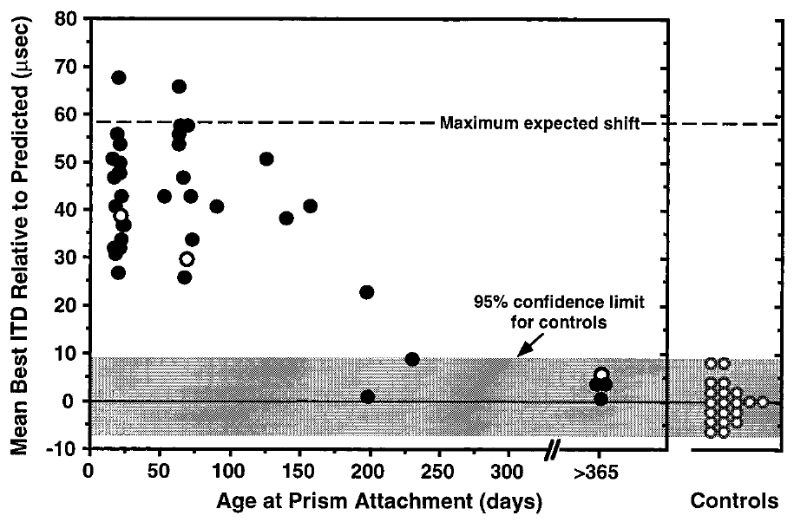
Novel map acquisition declines near 200 days
Brainard and Knudsen measured tectal adjustment after at least two months of prism experience. The displacement was held fixed while the age at introduction varied, which asked how much a new visual displacement could change auditory timing preferences at different developmental ages. The paper compared adaptation across several ages at which the prisms were first attached.
In the communal-aviary conditions, the capacity to acquire a large shift declined around 200 days of age. Older owls generally produced small shifts despite sustained 23° optical displacement. Some animals also had elevated auditory thresholds, which can alter the measured response. Elevated thresholds were noted because they change how strongly the owl responds to sound.
The boundary near 200 days belongs to this paradigm, with its communal aviary and fixed 23° displacement, rather than to a universal end of auditory learning. Recovering an established map and acquiring a new one place different demands on the circuit. A bounded sensitive period is a finding about one housing setting and one displacement.
Brainard & Knudsen (1998), Fig. 3. Adaptive shift versus age at prism attachment.
Feldman & Knudsen (1998), Fig. 2(A). ICCls, ICX, and optic-tectum locations.
Brainard & Knudsen (1998)
10
Notes:
Teaching transcript:
Brainard and Knudsen assessed the amount of tectal adjustment after at least two months of prism experience. The comparison asked how much a new visual displacement could change auditory timing preferences when introduced at different developmental ages.
In the communal-aviary conditions, the capacity to acquire a large shift declined around 200 days of age. Older owls generally produced small shifts despite sustained 23° optical displacement. The paper also identified animals with elevated auditory thresholds, because impaired sound sensitivity can affect the measured response.
The approximately 200-day boundary describes a particular manipulation and environment. It is not a claim that all auditory learning ends at that age. Recovery of a previously established map and acquisition of a new map are different experimental demands.
An auditory threshold is the minimum sound level that reliably evokes a response. Threshold changes must be distinguished from changes in the preferred timing cue.
References:
Michael S. Brainard; Eric I. Knudsen (1998). Sensitive Periods for Visual Calibration of the Auditory Space Map in the Barn Owl Optic Tectum. The Journal of Neuroscience 18(10):3929-3942. https://doi.org/10.1523/jneurosci.18-10-03929.1998
Daniel E. Feldman; Eric I. Knudsen (1998). Pharmacological Specialization of Learned Auditory Responses in the Inferior Colliculus of the Barn Owl. The Journal of Neuroscience 18(8):3073-3087. https://doi.org/10.1523/jneurosci.18-08-03073.1998
Brainard & Knudsen (1998), Fig. 3. Adaptive shift versus age at prism attachment.
Figure source: https://doi.org/10.1523/jneurosci.18-10-03929.1998
Feldman & Knudsen (1998), Fig. 2(A). ICCls, ICX, and optic-tectum locations.
Figure source: https://doi.org/10.1523/jneurosci.18-08-03073.1998

Slide 14
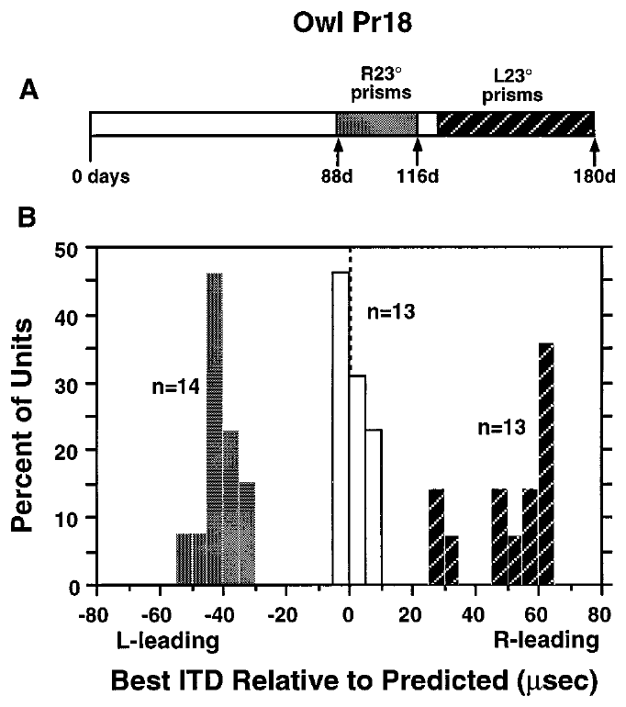
A juvenile map can learn opposite displacements
A developmental sensitive period permits more than one adjustment. Brainard and Knudsen reversed the direction of the visual displacement in a juvenile owl and measured how tectal timing preferences responded to the new sensory relationship. The reversed prism condition tests whether an established map can be replaced. The result tests how flexible the juvenile map is.
An owl fitted with rightward 23° prisms at 88 days shifted its auditory map after 28 days. After the prisms were changed to leftward 23°, a further 56-day period produced adjustment in the opposite direction. The same animal therefore acquired different cue-to-location relationships during development. Each adjustment was measured against the displacement in place at that time.
This reversal argues against a fixed anatomical offset as the full explanation for prism adaptation. It supports experience-dependent selection of timing inputs. How the reversal is implemented, through new connections, altered synaptic strengths, or changed inhibition, is an open question. Each mechanism would predict a different pattern of change. Each one predicts a different pattern.
Brainard & Knudsen (1998), Fig. 5(A–B). Tuning distributions after opposite prism directions.
Feldman & Knudsen (1998), Fig. 2(A). ICCls, ICX, and optic-tectum locations.
Brainard & Knudsen (1998)
11
Notes:
Teaching transcript:
A developmental sensitive period permits more than a single irreversible adjustment. Brainard and Knudsen changed the direction of the visual displacement in a juvenile owl and measured how tectal timing preferences responded to the new sensory relationship.
An owl fitted with rightward 23° prisms at 88 days shifted its auditory map after 28 days. After the prisms were changed to leftward 23°, a subsequent 56-day period produced adjustment in the opposite direction. The same animal therefore acquired different cue-to-location relationships within development.
This reversal argues against a fixed anatomical offset being the entire explanation for prism adaptation. It supports experience-dependent selection of timing inputs, while not deciding whether reversal uses new connections, altered synaptic strengths, or changes in inhibition.
Reversal of the imposed displacement changes which ITDs are adaptive. The measured response must be evaluated relative to the new optical condition.
References:
Michael S. Brainard; Eric I. Knudsen (1998). Sensitive Periods for Visual Calibration of the Auditory Space Map in the Barn Owl Optic Tectum. The Journal of Neuroscience 18(10):3929-3942. https://doi.org/10.1523/jneurosci.18-10-03929.1998
Daniel E. Feldman; Eric I. Knudsen (1998). Pharmacological Specialization of Learned Auditory Responses in the Inferior Colliculus of the Barn Owl. The Journal of Neuroscience 18(8):3073-3087. https://doi.org/10.1523/jneurosci.18-08-03073.1998
Brainard & Knudsen (1998), Fig. 5(A–B). Tuning distributions after opposite prism directions.
Figure source: https://doi.org/10.1523/jneurosci.18-10-03929.1998
Feldman & Knudsen (1998), Fig. 2(A). ICCls, ICX, and optic-tectum locations.
Figure source: https://doi.org/10.1523/jneurosci.18-08-03073.1998

Slide 15
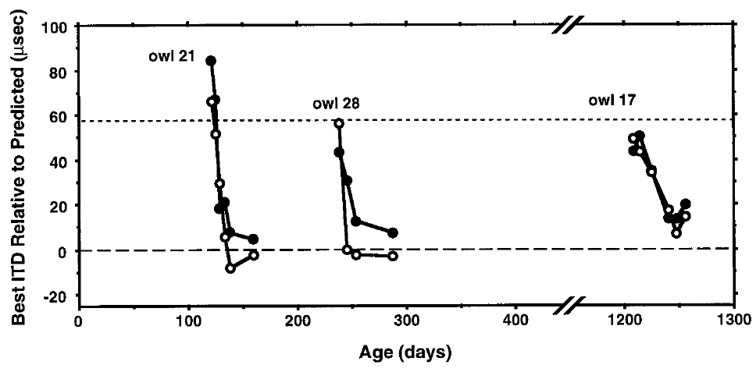
Normal vision can restore a previously calibrated map
Restoring normal vision asks the auditory system to return to a previously established cue-to-location relationship. Brainard and Knudsen removed prisms and followed preferred ITDs with chronic tectal recordings, which gave a direct comparison with the shifted map measured just before removal. Each animal served as its own control across the removal. Recovery was then tracked.
Owls whose prisms were removed at 108, 238, and 1,208 days of age recovered normal tuning during the subsequent period of normal vision. The oldest animal recovered as well, while it lived in the rich communal environment. The 1,208-day animal shows that recovery did not depend on youth alone in these owls.
Recovery is a different process from acquiring a novel displacement. An adult circuit can retain access to a normal calibration that it fails to express under prism conditions. Recovery alone leaves open whether that access reflects persistent connections or relearning from scratch. A normal calibration can be expressed again once the sensory relationship returns to normal.
Brainard & Knudsen (1998), Fig. 6. Recovery after prism removal at different ages.
Feldman & Knudsen (1998), Fig. 2(A). ICCls, ICX, and optic-tectum locations.
Brainard & Knudsen (1998)
12
Notes:
Teaching transcript:
Restoring normal vision asks the system to return to a previously established cue-to-location relationship. Brainard and Knudsen removed prisms and followed preferred ITDs using chronic tectal recordings, providing a direct comparison with the shifted map immediately before removal.
Owls whose prisms were removed at 108, 238, and 1,208 days of age recovered normal tuning over the subsequent period of normal vision. Recovery occurred even in the oldest animal when it lived in the rich communal environment.
The result separates recovery from the acquisition of a novel displacement. An adult circuit can retain access to a normal calibration that it does not express under prism conditions. Recovery alone does not reveal whether that access reflects persistent anatomical connections or relearning from scratch.
Prism removal restores the visual reference without reversing the direction of the auditory waveform. The experimental outcome is the reappearance of normal auditory preferences.
References:
Michael S. Brainard; Eric I. Knudsen (1998). Sensitive Periods for Visual Calibration of the Auditory Space Map in the Barn Owl Optic Tectum. The Journal of Neuroscience 18(10):3929-3942. https://doi.org/10.1523/jneurosci.18-10-03929.1998
Daniel E. Feldman; Eric I. Knudsen (1998). Pharmacological Specialization of Learned Auditory Responses in the Inferior Colliculus of the Barn Owl. The Journal of Neuroscience 18(8):3073-3087. https://doi.org/10.1523/jneurosci.18-08-03073.1998
Brainard & Knudsen (1998), Fig. 6. Recovery after prism removal at different ages.
Figure source: https://doi.org/10.1523/jneurosci.18-10-03929.1998
Feldman & Knudsen (1998), Fig. 2(A). ICCls, ICX, and optic-tectum locations.
Figure source: https://doi.org/10.1523/jneurosci.18-08-03073.1998

Slide 16
Orienting error measures behavior, not tuning
Auditory orienting error is the difference between the direction of a sound source and the owl's head orientation. It is a behavioral quantity distinct from the neuronal best ITD, and both were assessed in the cage and aviary experiments. Each measure reports a different aspect of the adjustment.
The strength of adaptation to a novel displacement is one question, and the ability to recover a normal mapping after prism removal is another. Those two abilities place their own requirements on the circuit, so the two measures should be kept apart. Neural recovery and behavioral recovery were tested as distinct outcomes.
An auditory threshold is the minimum sound level that reliably evokes a response. Changes in threshold must be distinguished from changes in the preferred timing cue. Impaired sound sensitivity can alter a measured response, so the threshold measure guards the timing result. Its change is measured separately from the timing shift.
Brainard & Knudsen (1998), Fig. 6. Recovery after prism removal at different ages.
Feldman & Knudsen (1998), Fig. 2(A). ICCls, ICX, and optic-tectum locations.
Brainard & Knudsen (1998)
12a
Notes:
Orienting error measures behavior, not tuning.
Explanation 1.
Auditory orienting error is the difference between the direction of a sound source and the owl's head orientation
It is a behavioral quantity distinct from the neuronal best ITD, and both were assessed in the cage and aviary experiments. Each measure reports a different aspect of the adjustment.
Explanation 2.
The strength of adaptation to a novel displacement is one question, and the ability to recover a normal mapping after prism removal is another
Those two abilities place their own requirements on the circuit, so the two measures should be kept apart. Neural recovery and behavioral recovery were tested as distinct outcomes.
Explanation 3.
An auditory threshold is the minimum sound level that reliably evokes a response
Changes in threshold must be distinguished from changes in the preferred timing cue. Impaired sound sensitivity can alter a measured response, so the threshold measure guards the timing result. Its change is measured separately from the timing shift.
Source.
The figure and its data come from Brainard & Knudsen (1998).
The full references are listed below.
References:
Michael S. Brainard; Eric I. Knudsen (1998). Sensitive Periods for Visual Calibration of the Auditory Space Map in the Barn Owl Optic Tectum. The Journal of Neuroscience 18(10):3929-3942. https://doi.org/10.1523/jneurosci.18-10-03929.1998

Slide 17
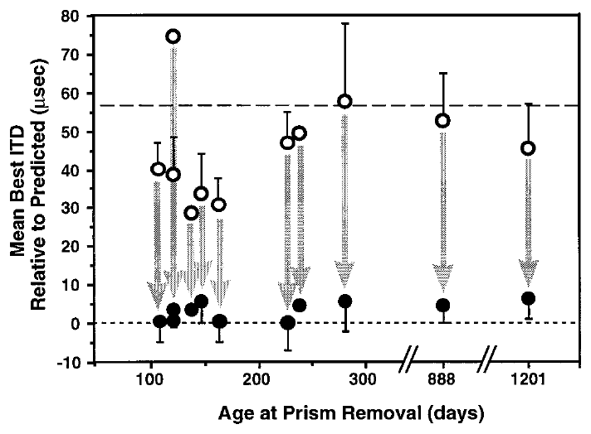
Recovery and new learning have different age limits
A circuit's capacity for plasticity depends on the adjustment it must make. Brainard and Knudsen compared auditory tuning just before prism removal with tuning after at least one month of normal visual experience in owls of different ages. Comparing the two conditions isolates the demands of each adjustment. Recovery and new learning were tested separately.
Recovery toward the normal auditory map occurred across the tested age range in communal aviaries, including animals older than two years. In contrast, acquiring a large novel shift was strongly reduced when a 23° displacement was first introduced late in life. Owls older than two years were included in the recovery group in communal aviaries.
These outcomes support distinct constraints on establishing an unfamiliar mapping and on returning to a familiar one. They point away from a single age after which all auditory-map change becomes impossible, and the anatomical basis of the split calls for direct tracing. The two constraints appear as separate capacities in the same animals.
Brainard & Knudsen (1998), Fig. 7. Preferred timing before and after prism removal.
Feldman & Knudsen (1998), Fig. 2(A). ICCls, ICX, and optic-tectum locations.
Brainard & Knudsen (1998)
13
Notes:
Teaching transcript:
A circuit’s capacity for plasticity depends on the adjustment required. Brainard and Knudsen compared auditory tuning immediately before prism removal with tuning after at least one month of normal visual experience in owls of different ages.
Recovery toward the normal auditory map occurred across the tested age range in communal aviaries, including animals older than two years. By contrast, acquisition of a large novel shift was strongly reduced when a 23° displacement was first introduced late in life.
These outcomes do not support a single age at which all auditory-map change becomes impossible. They support distinct constraints on establishing an unfamiliar mapping and returning to a familiar one. The distinction is behavioral and physiological; its anatomical explanation requires direct tracing evidence.
Prior calibration provides a different starting circuit state from the state of an adult encountering an unfamiliar optical displacement.
References:
Michael S. Brainard; Eric I. Knudsen (1998). Sensitive Periods for Visual Calibration of the Auditory Space Map in the Barn Owl Optic Tectum. The Journal of Neuroscience 18(10):3929-3942. https://doi.org/10.1523/jneurosci.18-10-03929.1998
Daniel E. Feldman; Eric I. Knudsen (1998). Pharmacological Specialization of Learned Auditory Responses in the Inferior Colliculus of the Barn Owl. The Journal of Neuroscience 18(8):3073-3087. https://doi.org/10.1523/jneurosci.18-08-03073.1998
Brainard & Knudsen (1998), Fig. 7. Preferred timing before and after prism removal.
Figure source: https://doi.org/10.1523/jneurosci.18-10-03929.1998
Feldman & Knudsen (1998), Fig. 2(A). ICCls, ICX, and optic-tectum locations.
Figure source: https://doi.org/10.1523/jneurosci.18-08-03073.1998

Slide 18
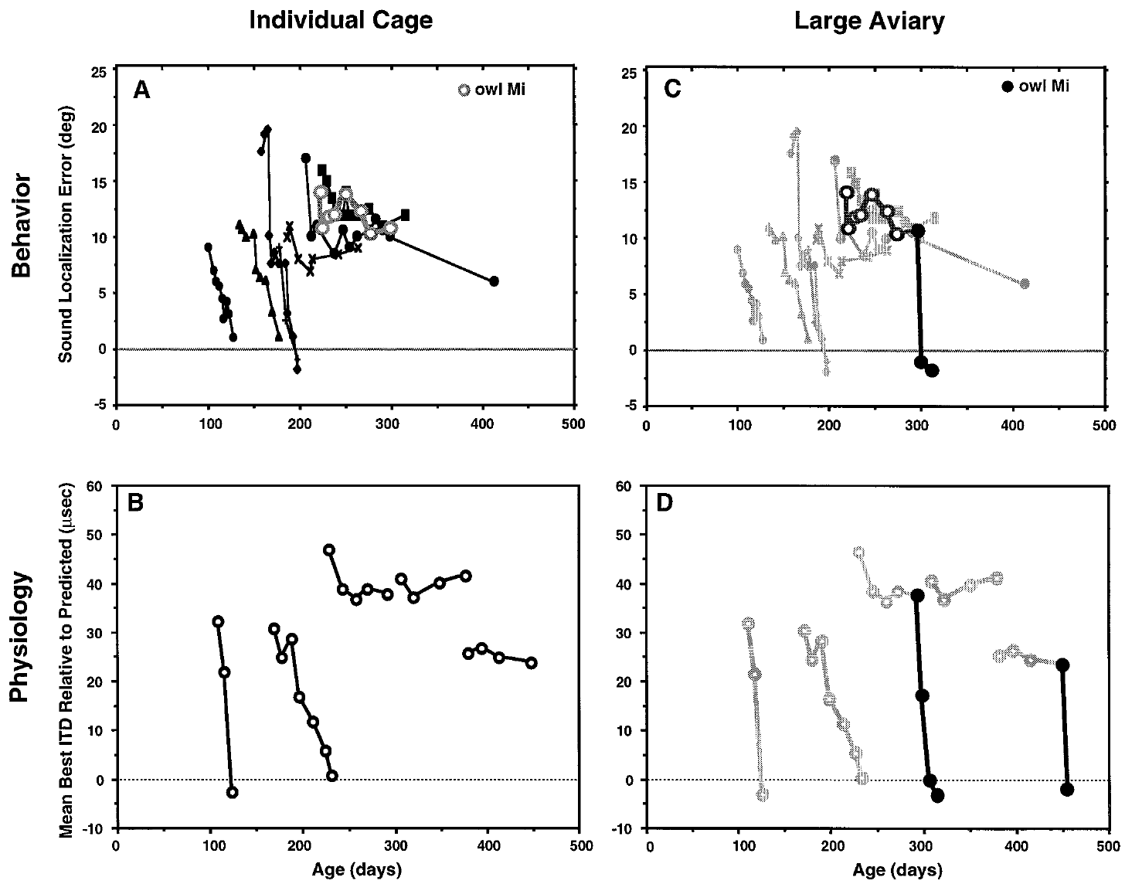
An impoverished environment restricts recovery
Brainard and Knudsen tested whether housing conditions contributed to the apparently different sensitive periods. Owls in small individual cages could see and hear other owls, but they could not fly or interact directly with them as they could in a communal aviary. The cages restricted flight, which the aviary allowed. Cage housing restricted movement between owls.
After normal vision was restored, younger animals recovered accurate localization and normal tectal timing. Animals older than about 200 days often failed to recover while they remained in the small cages. Localization accuracy and tectal timing were the two recovery measures, and both were assessed. Animals older than about 200 days showed the failure pattern while housed in the small cages.
The cage manipulation changed several aspects of experience together. Environmental dependence is therefore established without isolating flight, social interaction, attention, or sensory richness as the single cause of the age limit. The result connects environmental conditions to the expressed adjustment without isolating the cause. Housing was the change that differed between the two settings.
Brainard & Knudsen (1998), Fig. 8(A–B). Recovery while owls lived in individual cages.
Feldman & Knudsen (1998), Fig. 2(A). ICCls, ICX, and optic-tectum locations.
Brainard & Knudsen (1998)
14
Notes:
Teaching transcript:
Brainard and Knudsen tested whether housing conditions contributed to apparently different sensitive periods. Owls in small individual cages could see and hear other owls but could not fly or interact directly with them as they could in a communal aviary.
After normal vision was restored, younger animals recovered accurate localization and normal tectal timing. Animals older than approximately 200 days often failed to recover while they remained in the small cages. Both neural tuning and auditory orienting were assessed, linking environmental conditions with the expressed adjustment.
The cage manipulation changed several aspects of experience together. It therefore identifies environmental dependence without isolating flight, social interaction, attention, or sensory richness as the sole cause. The age limit applies to these restricted conditions.
Auditory orienting error measures the difference between sound-source direction and the owl’s head orientation. It is a behavioral quantity distinct from neuronal best ITD.
References:
Michael S. Brainard; Eric I. Knudsen (1998). Sensitive Periods for Visual Calibration of the Auditory Space Map in the Barn Owl Optic Tectum. The Journal of Neuroscience 18(10):3929-3942. https://doi.org/10.1523/jneurosci.18-10-03929.1998
Daniel E. Feldman; Eric I. Knudsen (1998). Pharmacological Specialization of Learned Auditory Responses in the Inferior Colliculus of the Barn Owl. The Journal of Neuroscience 18(8):3073-3087. https://doi.org/10.1523/jneurosci.18-08-03073.1998
Brainard & Knudsen (1998), Fig. 8(A–B). Recovery while owls lived in individual cages.
Figure source: https://doi.org/10.1523/jneurosci.18-10-03929.1998
Feldman & Knudsen (1998), Fig. 2(A). ICCls, ICX, and optic-tectum locations.
Figure source: https://doi.org/10.1523/jneurosci.18-08-03073.1998

Slide 19
A richer environment can reopen expressed recovery
Environmental conditions can change how much adult auditory plasticity is expressed after an initial failure to adapt. Brainard and Knudsen moved prism-reared owls from individual cages to a large aviary after normal vision had been restored. The change in housing followed a period of normal vision. The move came after the prisms were removed.
One owl had its prisms removed at 219 days and showed little behavioral correction over 76 days in a cage. After transfer at 295 days, its localization accuracy improved. Adult owls that had failed to restore normal tectal timing in cages also recovered once they were moved to the aviary. Its cage period came first.
These comparisons argue against explanations based solely on irreversible loss of developmental capacity. Some capacity remained available but depended on the environment. The transfer did not select one neurotransmitter or circuit, so the immediate biological trigger is still to be identified. Explanations based on fixed developmental loss must account for recovery after housing changes.
Brainard & Knudsen (1998), Fig. 8(C–D). Recovery after transfer from cages to an aviary.
Feldman & Knudsen (1998), Fig. 2(A). ICCls, ICX, and optic-tectum locations.
Brainard & Knudsen (1998)
15
Notes:
Teaching transcript:
Environmental conditions can change the expression of adult auditory plasticity after an initial failure to adapt. Brainard and Knudsen transferred prism-reared owls from individual cages to a large aviary after normal vision had been restored.
One owl had prisms removed at 219 days and showed little behavioral correction during 76 days in a cage. After transfer at 295 days, its localization accuracy improved. Adult owls that had failed to restore normal tectal timing in cages also recovered after transfer to the aviary.
These comparisons constrain explanations based only on irreversible loss of developmental capacity. Some capacity remained available but depended on the animal’s environment. The transfer was not a selective manipulation of one neurotransmitter or one circuit, so the immediate biological trigger remains unresolved.
The change in housing occurred after the visual manipulation was reversed. This sequence separates availability of normal visual information from the conditions needed to use it.
References:
Michael S. Brainard; Eric I. Knudsen (1998). Sensitive Periods for Visual Calibration of the Auditory Space Map in the Barn Owl Optic Tectum. The Journal of Neuroscience 18(10):3929-3942. https://doi.org/10.1523/jneurosci.18-10-03929.1998
Daniel E. Feldman; Eric I. Knudsen (1998). Pharmacological Specialization of Learned Auditory Responses in the Inferior Colliculus of the Barn Owl. The Journal of Neuroscience 18(8):3073-3087. https://doi.org/10.1523/jneurosci.18-08-03073.1998
Brainard & Knudsen (1998), Fig. 8(C–D). Recovery after transfer from cages to an aviary.
Figure source: https://doi.org/10.1523/jneurosci.18-10-03929.1998
Feldman & Knudsen (1998), Fig. 2(A). ICCls, ICX, and optic-tectum locations.
Figure source: https://doi.org/10.1523/jneurosci.18-08-03073.1998

Slide 20
Housing order distinguishes input from its use
Prior calibration provides a different starting circuit state from the state of an adult encountering an unfamiliar optical displacement. The owls here had already regained normal vision when the housing changed. Normal visual input was in place before the aviary transfer. Housing was changed once the visual input had already returned.
Sensory calibration in these owls was reversed by restoring normal vision, and the animals were moved afterward. Reversal of the imposed displacement changes which ITDs are adaptive. The measured response must be judged against the new optical condition. The starting state of each animal shapes what the transfer can reveal.
The housing change followed the visual manipulation rather than preceding it, so the two factors were applied in sequence. The mechanism behind the aviary effect is still to be identified. The aviary period changed the expression of an existing capacity rather than creating one.
Brainard & Knudsen (1998), Fig. 8(C–D). Recovery after transfer from cages to an aviary.
Feldman & Knudsen (1998), Fig. 2(A). ICCls, ICX, and optic-tectum locations.
Brainard & Knudsen (1998)
15a
Notes:
Housing order distinguishes input from its use.
Explanation 1.
Prior calibration provides a different starting circuit state from the state of an adult encountering an unfamiliar optical displacement
The owls here had already regained normal vision when the housing changed. Normal visual input was in place before the aviary transfer. Housing was changed once the visual input had already returned.
Explanation 2.
Sensory calibration in these owls was reversed by restoring normal vision, and the animals were moved afterward
Reversal of the imposed displacement changes which ITDs are adaptive. The measured response must be judged against the new optical condition. The starting state of each animal shapes what the transfer can reveal.
Explanation 3.
The housing change followed the visual manipulation rather than preceding it, so the two factors were applied in sequence
The mechanism behind the aviary effect is still to be identified. The aviary period changed the expression of an existing capacity rather than creating one.
Source.
The figure and its data come from Brainard & Knudsen (1998).
The full references are listed below.
References:
Michael S. Brainard; Eric I. Knudsen (1998). Sensitive Periods for Visual Calibration of the Auditory Space Map in the Barn Owl Optic Tectum. The Journal of Neuroscience 18(10):3929-3942. https://doi.org/10.1523/jneurosci.18-10-03929.1998

Slide 21
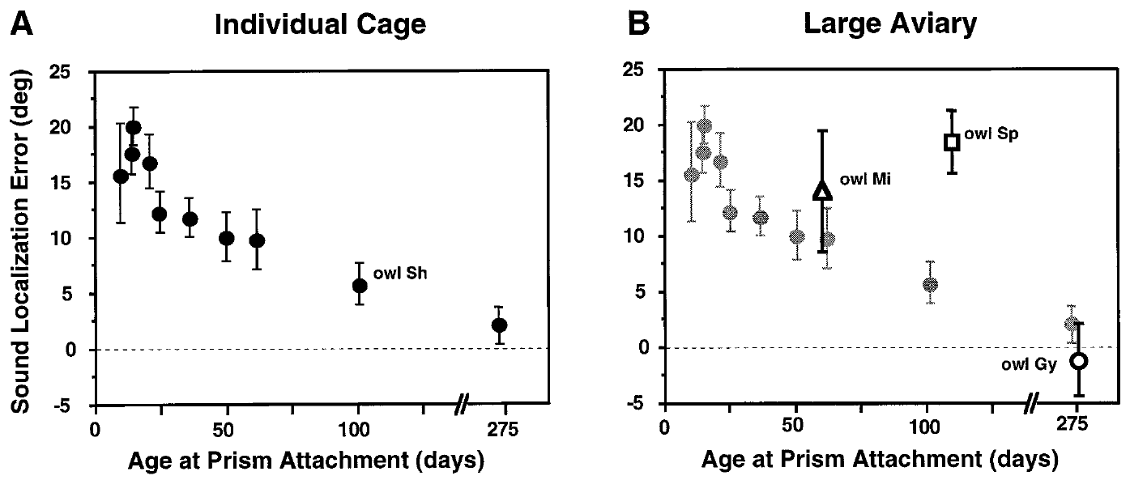
Housing conditions shift the apparent sensitive period
Sensitive-period measurements depend on the experience an animal receives. Brainard and Knudsen assessed auditory orienting after at least 60 days of 23° prism exposure in owls housed individually and in owls housed in a large aviary. Both groups were examined after the same duration of prism wear. Owls at several attachment ages were covered across both housing conditions.
In the cage conditions, substantial behavioral adjustment was restricted to much younger animals, around 70 days at prism attachment. In the richer aviary, later juvenile experience could still support adjustment. This difference helped reconcile behavioral age limits with the longer period seen in neural recordings. The aviary result extended the age range in which later juvenile experience could still support adjustment.
Age and environment jointly influence how much adaptation is expressed. A sensitive period measured in one housing condition can look like a universal deadline when it is actually condition dependent. The richer environment widened the age range over which adjustment was observed. Housing and age interact, so the boundary depends on both.
Brainard & Knudsen (1998), Fig. 9(A–B). Age-dependent behavioral adjustment in two environments.
Feldman & Knudsen (1998), Fig. 2(A). ICCls, ICX, and optic-tectum locations.
Brainard & Knudsen (1998)
16
Notes:
Teaching transcript:
Sensitive-period measurements depend on the experience provided to the animal. Brainard and Knudsen compared auditory orienting after at least 60 days of 23° prism exposure in owls housed individually and in owls housed in a large aviary.
In the earlier cage conditions, substantial behavioral adjustment was restricted to much younger animals, around 70 days at prism attachment. In the richer environment, later juvenile experience could still support adjustment. This difference helped reconcile behavioral age limits with the longer period measured in neural recordings.
The result does not eliminate developmental constraints. It indicates that age and environment jointly influence the amount of adaptation that is expressed. Comparing studies without accounting for housing can mistakenly turn a condition-dependent sensitive period into a universal biological deadline.
The comparison concerns the strength of adaptation to a novel displacement. It differs from the ability to recover a normal mapping after prism removal.
References:
Michael S. Brainard; Eric I. Knudsen (1998). Sensitive Periods for Visual Calibration of the Auditory Space Map in the Barn Owl Optic Tectum. The Journal of Neuroscience 18(10):3929-3942. https://doi.org/10.1523/jneurosci.18-10-03929.1998
Daniel E. Feldman; Eric I. Knudsen (1998). Pharmacological Specialization of Learned Auditory Responses in the Inferior Colliculus of the Barn Owl. The Journal of Neuroscience 18(8):3073-3087. https://doi.org/10.1523/jneurosci.18-08-03073.1998
Brainard & Knudsen (1998), Fig. 9(A–B). Age-dependent behavioral adjustment in two environments.
Figure source: https://doi.org/10.1523/jneurosci.18-10-03929.1998
Feldman & Knudsen (1998), Fig. 2(A). ICCls, ICX, and optic-tectum locations.
Figure source: https://doi.org/10.1523/jneurosci.18-08-03073.1998

Slide 22
Regional visual information can instruct local tuning
A topographic instructive signal supplies location-specific information about how a neural representation should change. Hyde and Knudsen tested this idea against instruction based solely on whether an orienting movement ended at the correct central visual position. Instruction of this kind is a spatial signal, not a general error message. Central gaze defines one region of instruction, and the peripheral field defines another.
After initial adaptation to leftward 23° prisms, one owl had normal vision centrally while the field beyond 15° was occluded. After 11 days, central tectal timing moved toward normal, while the occluded peripheral representation changed much less. The 11-day interval was measured from the start of normal central vision. That timing defined the regional comparison for this owl.
Regional differences of this kind support a point-by-point visual contribution to calibration. Instruction derived from central gaze alone would predict a more uniform change across the map, so the spatial pattern itself carries information about which visual positions supply the instruction. Spatial organization of the signal is visible in the regional pattern of change.
Hyde & Knudsen (2001), Fig. 1(A–F). Central recovery with peripheral visual occlusion.
Feldman & Knudsen (1998), Fig. 2(A). ICCls, ICX, and optic-tectum locations.
Hyde & Knudsen (2001)
17
Notes:
Teaching transcript:
A topographic instructive signal supplies location-specific information about how a neural representation should change. Hyde and Knudsen distinguished this possibility from instruction based only on whether an auditory orienting movement ended at the correct central visual position.
After initial adaptation to leftward 23° prisms, one owl experienced normal vision centrally while the peripheral field beyond 15° was occluded. After 11 days, central tectal timing moved toward normal while the occluded peripheral representation changed much less.
Different regional adjustments support a point-by-point visual contribution to calibration. A teaching signal derived solely from central gaze would predict a more uniform change. The experiment identifies the spatial organization of instruction without directly recording the neurons that carry it.
Center-of-gaze and peripheral manipulations create different visual conditions within one animal, providing an internal comparison between regions of the map.
References:
Peter S. Hyde; Eric I. Knudsen (2001). A Topographic Instructive Signal Guides the Adjustment of the Auditory Space Map in the Optic Tectum. The Journal of Neuroscience 21(21):8586-8593. https://doi.org/10.1523/jneurosci.21-21-08586.2001
Daniel E. Feldman; Eric I. Knudsen (1998). Pharmacological Specialization of Learned Auditory Responses in the Inferior Colliculus of the Barn Owl. The Journal of Neuroscience 18(8):3073-3087. https://doi.org/10.1523/jneurosci.18-08-03073.1998
Hyde & Knudsen (2001), Fig. 1(A–F). Central recovery with peripheral visual occlusion.
Figure source: https://doi.org/10.1523/jneurosci.21-21-08586.2001
Feldman & Knudsen (1998), Fig. 2(A). ICCls, ICX, and optic-tectum locations.
Figure source: https://doi.org/10.1523/jneurosci.18-08-03073.1998

Slide 23
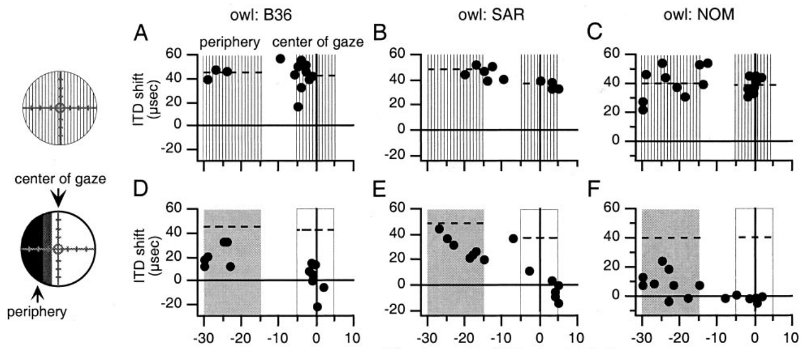
Occluded map regions receive less effective instruction
Hyde and Knudsen repeated the regional manipulations in several prism-adapted owls. They compared preferred auditory timing across tectal sites that represent the center of gaze with sites representing the occluded peripheral field. Both regions were measured within the same owls, which controls for the animal and its history. Each owl served as its own reference, which limits variation across animals.
After 14–35 days with normal central vision and peripheral occlusion, auditory tuning changed more in the centrally instructed region. Each owl's previously measured prism-adapted map served as the reference, which left the regional difference in visual experience intact across the recovery interval. The centrally instructed region changed more in every owl compared at this stage.
Occlusion therefore did more than reduce total visual stimulation. It limited the information available to the matching part of the map. Local visual instruction is one component of the adjustment rather than its entire basis, because other global influences remain possible. Regional occlusion changes the instruction without removing the whole visual input.
Hyde & Knudsen (2001), Fig. 2(A–F). Regional responses after peripheral occlusion.
Feldman & Knudsen (1998), Fig. 2(A). ICCls, ICX, and optic-tectum locations.
Hyde & Knudsen (2001)
18
Notes:
Teaching transcript:
Hyde and Knudsen repeated regional manipulations in several prism-adapted owls. They compared preferred auditory timing across tectal sites representing the center of gaze and sites representing an occluded peripheral visual region.
Following 14–35 days with normal central vision and peripheral occlusion, changes in auditory tuning were generally larger in the centrally instructed region. The comparison used each owl’s previously measured prism-adapted map as the reference and preserved the regional distinction in visual experience.
Occlusion therefore did more than reduce the total amount of visual stimulation. It limited the effective information available to a corresponding part of the map. The data remain compatible with additional global influences, because absence of local visual instruction need not eliminate every source of auditory change.
A location-specific difference within the same brain is especially informative when the animal’s age, general housing conditions, and prismatic history are shared.
References:
Peter S. Hyde; Eric I. Knudsen (2001). A Topographic Instructive Signal Guides the Adjustment of the Auditory Space Map in the Optic Tectum. The Journal of Neuroscience 21(21):8586-8593. https://doi.org/10.1523/jneurosci.21-21-08586.2001
Daniel E. Feldman; Eric I. Knudsen (1998). Pharmacological Specialization of Learned Auditory Responses in the Inferior Colliculus of the Barn Owl. The Journal of Neuroscience 18(8):3073-3087. https://doi.org/10.1523/jneurosci.18-08-03073.1998
Hyde & Knudsen (2001), Fig. 2(A–F). Regional responses after peripheral occlusion.
Figure source: https://doi.org/10.1523/jneurosci.21-21-08586.2001
Feldman & Knudsen (1998), Fig. 2(A). ICCls, ICX, and optic-tectum locations.
Figure source: https://doi.org/10.1523/jneurosci.18-08-03073.1998

Slide 24
A paired regional comparison controls history
Center-of-gaze and peripheral manipulations create different visual conditions within one animal, which gives an internal comparison between regions of the map. Both regions share the animal's age, housing, and prism history. Their difference reflects the visual condition alone. Every region was measured within the same owl, so no values were averaged across individuals.
A location-specific difference within the same brain is especially informative when age, general housing conditions, and prismatic history are shared. That is the situation these paired regions provide. Regional contrasts within one owl are the variable of interest, because the other conditions are fixed. Local signals and global signals predict different spatial patterns of change.
The study distinguishes the spatial pattern of instruction from the cellular implementation of learning. A topographic outcome leaves the learning algorithm unspecified. The regional measurements identify where change occurs, not which cellular rule produces it.
Hyde & Knudsen (2001), Fig. 2(A–F). Regional responses after peripheral occlusion.
Feldman & Knudsen (1998), Fig. 2(A). ICCls, ICX, and optic-tectum locations.
Hyde & Knudsen (2001)
18a
Notes:
A paired regional comparison controls history.
Explanation 1.
Center-of-gaze and peripheral manipulations create different visual conditions within one animal, which gives an internal comparison between regions of the map
Both regions share the animal's age, housing, and prism history. Their difference reflects the visual condition alone. Every region was measured within the same owl, so no values were averaged across individuals.
Explanation 2.
A location-specific difference within the same brain is especially informative when age, general housing conditions, and prismatic history are shared
That is the situation these paired regions provide. Regional contrasts within one owl are the variable of interest, because the other conditions are fixed. Local signals and global signals predict different spatial patterns of change.
Explanation 3.
The study distinguishes the spatial pattern of instruction from the cellular implementation of learning
A topographic outcome leaves the learning algorithm unspecified. The regional measurements identify where change occurs, not which cellular rule produces it.
Source.
The figure and its data come from Hyde & Knudsen (2001).
The full references are listed below.
References:
Peter S. Hyde; Eric I. Knudsen (2001). A Topographic Instructive Signal Guides the Adjustment of the Auditory Space Map in the Optic Tectum. The Journal of Neuroscience 21(21):8586-8593. https://doi.org/10.1523/jneurosci.21-21-08586.2001

Slide 25
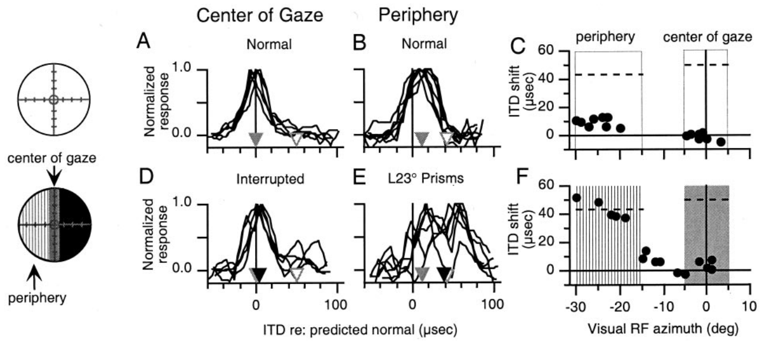
Peripheral vision can drive peripheral remapping
A local teaching signal should work in the periphery as well as at the center of gaze. Hyde and Knudsen tested this by interrupting central vision intermittently while imposing a 23° prismatic displacement on the peripheral visual field. Both regions shared the same owl and the same prism history. The peripheral displacement was present during intermittent central interruption.
After 21 days, auditory timing changed more in the peripheral representation that experienced the displaced visual scene. The central representation, whose visual input was interrupted, adjusted less. Normal-vision measurements taken just before the manipulation fixed each region's starting condition. Interruption of central vision did not stop the displaced peripheral input from instructing its own region.
That result is hard to explain with a teaching signal based entirely on central foveation accuracy. The findings support spatially distributed visual instruction, and the pathways that carry peripheral and central instruction form a separate question. Interrupting central vision did not remove the peripheral instruction, and the displaced peripheral field still drove change.
Hyde & Knudsen (2001), Fig. 3(A–F). Displaced peripheral vision with interrupted central vision.
Feldman & Knudsen (1998), Fig. 2(A). ICCls, ICX, and optic-tectum locations.
Hyde & Knudsen (2001)
19
Notes:
Teaching transcript:
A local teaching signal should work in the periphery as well as at the center of gaze. Hyde and Knudsen tested this by interrupting central vision intermittently while imposing a 23° prismatic displacement on the peripheral visual field.
After 21 days, auditory timing changed more in the peripheral representation that experienced the displaced visual scene. The central representation, whose visual input was interrupted, adjusted less. Normal-vision measurements immediately before the manipulation established each region’s starting condition.
This result is difficult to explain by a teaching signal that depends exclusively on the accuracy of central foveation. It supports spatially distributed visual instruction. It does not establish that peripheral instruction and central instruction use completely separate neural pathways.
Foveation means directing the visual axis toward a target. A purely foveation-based signal would use the outcome of that movement as its teaching information.
References:
Peter S. Hyde; Eric I. Knudsen (2001). A Topographic Instructive Signal Guides the Adjustment of the Auditory Space Map in the Optic Tectum. The Journal of Neuroscience 21(21):8586-8593. https://doi.org/10.1523/jneurosci.21-21-08586.2001
Daniel E. Feldman; Eric I. Knudsen (1998). Pharmacological Specialization of Learned Auditory Responses in the Inferior Colliculus of the Barn Owl. The Journal of Neuroscience 18(8):3073-3087. https://doi.org/10.1523/jneurosci.18-08-03073.1998
Hyde & Knudsen (2001), Fig. 3(A–F). Displaced peripheral vision with interrupted central vision.
Figure source: https://doi.org/10.1523/jneurosci.21-21-08586.2001
Feldman & Knudsen (1998), Fig. 2(A). ICCls, ICX, and optic-tectum locations.
Figure source: https://doi.org/10.1523/jneurosci.18-08-03073.1998

Slide 26
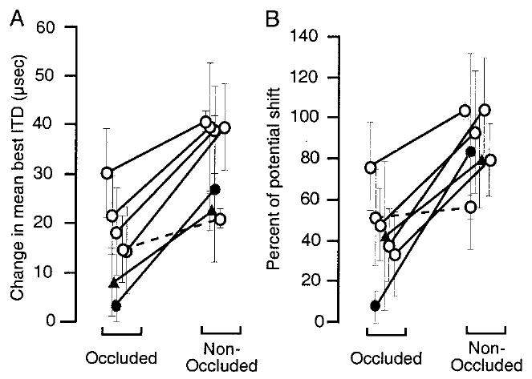
Visual instruction does not require uniform map change
The auditory map can adjust differently in regions that experienced different optical conditions. Hyde and Knudsen compared changes in the tectal representation of visually occluded and nonoccluded regions across their manipulations. Occluded and nonoccluded regions were compared within the same map. Regional comparisons identify where the instruction acts, not how it acts within a single cell.
In most experiments, the nonoccluded region changed more in the direction set by its visual experience. The imposed displacement was 23°, but the instruction acted regionally rather than as one command that moved every auditory preference by the same amount. Each occluded region was matched against the nonoccluded region in the same owl.
The findings fit topographic instruction, and other influences on map alignment remain possible. Whether error appears as a dedicated firing-rate signal or as another code is a mechanistic question beyond the regional measurements, and topographic instruction and cellular implementation are studied with different methods. The regional result supports a spatial pattern of instruction in the tectal map.
Hyde & Knudsen (2001), Fig. 5(A–B). Changes in occluded and nonoccluded map regions.
Feldman & Knudsen (1998), Fig. 2(A). ICCls, ICX, and optic-tectum locations.
Hyde & Knudsen (2001)
20
Notes:
Teaching transcript:
The auditory map can adjust differently in regions subjected to different optical conditions. Hyde and Knudsen compared changes in the tectal representation of visually occluded and nonoccluded regions across their experimental manipulations.
In most experiments, the nonoccluded region changed more in the direction specified by its visual experience. The imposed displacements were 23°, but their effective instruction was regional rather than a command to move every auditory preference by one identical amount.
The findings support topographic instruction while allowing additional influences on map alignment. They do not prove that error is encoded as a dedicated firing-rate signal or identify the visual-to-auditory synaptic rule. Those are mechanistic proposals beyond the directly measured regional changes.
The experiment distinguishes the spatial pattern of instruction from the cellular implementation of learning. A topographic outcome does not uniquely specify a learning algorithm.
References:
Peter S. Hyde; Eric I. Knudsen (2001). A Topographic Instructive Signal Guides the Adjustment of the Auditory Space Map in the Optic Tectum. The Journal of Neuroscience 21(21):8586-8593. https://doi.org/10.1523/jneurosci.21-21-08586.2001
Daniel E. Feldman; Eric I. Knudsen (1998). Pharmacological Specialization of Learned Auditory Responses in the Inferior Colliculus of the Barn Owl. The Journal of Neuroscience 18(8):3073-3087. https://doi.org/10.1523/jneurosci.18-08-03073.1998
Hyde & Knudsen (2001), Fig. 5(A–B). Changes in occluded and nonoccluded map regions.
Figure source: https://doi.org/10.1523/jneurosci.21-21-08586.2001
Feldman & Knudsen (1998), Fig. 2(A). ICCls, ICX, and optic-tectum locations.
Figure source: https://doi.org/10.1523/jneurosci.18-08-03073.1998

Slide 27
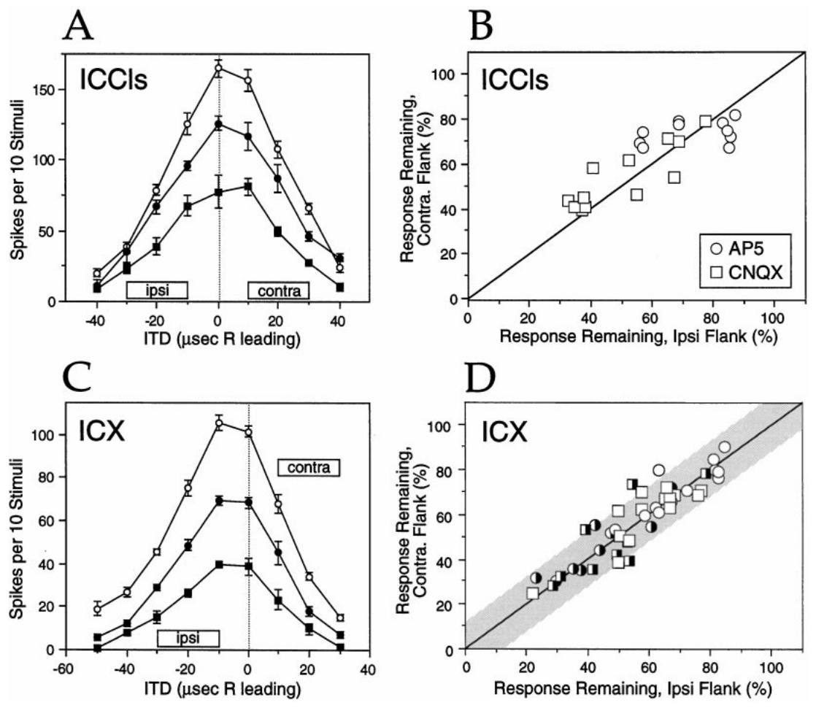
Glutamate receptors support auditory excitation
Glutamate is the excitatory transmitter examined in Feldman and Knudsen's collicular pharmacology experiments. NMDA and non-NMDA receptors are glutamate-activated ion channels whose contributions can be tested by applying antagonists near a recording site. Pharmacology applies drugs locally and then measures the response that follows. Ejection current sets how much drug leaves the pipette.
The authors used AP-5 to block NMDA receptors and CNQX to block non-NMDA receptors. In normal ICCls and ICX recordings, both drugs reduced auditory responses. Control and recovery measurements showed that each change followed reversible local drug application. The baseline came from the normal recordings. The reversal was seen in each recording.
An extracellular spike response reflects the combined action of synaptic currents and neuronal integration. Drug sensitivity therefore identifies a receptor contribution to that response, and the normal recordings supplied the baseline for interpreting learned responses. Local ejection makes it possible to test pharmacology in the same tissue across conditions. Each drug effect is therefore tied to recorded neurons.
Feldman & Knudsen (1998), Fig. 3(A–D). Receptor blockade in normal collicular recordings.
Feldman & Knudsen (1998), Fig. 2(A). ICCls, ICX, and optic-tectum locations.
Feldman & Knudsen (1998)
21
Notes:
Teaching transcript:
Glutamate is the excitatory transmitter considered in Feldman and Knudsen’s collicular pharmacology experiments. NMDA and non-NMDA receptors are glutamate-activated ion channels whose contributions can be tested by applying receptor antagonists near a recording site.
The authors used AP-5 to antagonize NMDA receptors and CNQX to antagonize non-NMDA receptors. In normal ICCls and ICX recordings, both drugs reduced auditory responses. Control and recovery measurements checked that the response change followed reversible local drug application.
An extracellular spike response measures the combined effect of synaptic currents and neuronal integration. Drug sensitivity establishes a receptor contribution to that response, not a direct count of receptors at an identified synapse. The normal recordings supplied the baseline for interpreting learned responses.
Iontophoresis uses electrical current to eject charged drug molecules from a recording pipette. The drug acts locally, although its precise concentration at each synapse is not directly measured.
References:
Daniel E. Feldman; Eric I. Knudsen (1998). Pharmacological Specialization of Learned Auditory Responses in the Inferior Colliculus of the Barn Owl. The Journal of Neuroscience 18(8):3073-3087. https://doi.org/10.1523/jneurosci.18-08-03073.1998
Feldman & Knudsen (1998), Fig. 3(A–D). Receptor blockade in normal collicular recordings.
Figure source: https://doi.org/10.1523/jneurosci.18-08-03073.1998
Feldman & Knudsen (1998), Fig. 2(A). ICCls, ICX, and optic-tectum locations.
Figure source: https://doi.org/10.1523/jneurosci.18-08-03073.1998

Slide 28
Drugs act through local ejection
Iontophoresis uses electrical current to eject charged drug molecules from a recording pipette. The drug acts locally, and its concentration at any single synapse goes unmeasured. The effect is tied to the neurons near the pipette. The ejection level in each trial sets the drug dose delivered. Recovery measurements confirmed that the drug effect was reversible.
A drug effect that is equal across two response components can arise from a change in one of them. Equal blockade alone leaves open which component changed. Two components can contribute to one spike response at once. Spike output reflects both components together, so drug effects are judged at the level of the response.
An adaptive flank is the side of a tuning curve toward the ITD values instructed by the prism displacement. The definition depends on the animal's experimental condition, not on the drug applied. Adaptive and nonadaptive flanks were measured on the same tuning curve. Learned responses in this study are identified by their ITD position.
Feldman & Knudsen (1998), Fig. 3(A–D). Receptor blockade in normal collicular recordings.
Feldman & Knudsen (1998), Fig. 2(A). ICCls, ICX, and optic-tectum locations.
Feldman & Knudsen (1998)
21a
Notes:
Drugs act through local ejection.
Explanation 1.
Iontophoresis uses electrical current to eject charged drug molecules from a recording pipette
The drug acts locally, and its concentration at any single synapse goes unmeasured. The effect is tied to the neurons near the pipette. The ejection level in each trial sets the drug dose delivered. Recovery measurements confirmed that the drug effect was reversible.
Explanation 2.
A drug effect that is equal across two response components can arise from a change in one of them
Equal blockade alone leaves open which component changed. Two components can contribute to one spike response at once. Spike output reflects both components together, so drug effects are judged at the level of the response.
Explanation 3.
An adaptive flank is the side of a tuning curve toward the ITD values instructed by the prism displacement
The definition depends on the animal's experimental condition, not on the drug applied. Adaptive and nonadaptive flanks were measured on the same tuning curve. Learned responses in this study are identified by their ITD position.
Source.
The figure and its data come from Feldman & Knudsen (1998).
The full references are listed below.
References:
Daniel E. Feldman; Eric I. Knudsen (1998). Pharmacological Specialization of Learned Auditory Responses in the Inferior Colliculus of the Barn Owl. The Journal of Neuroscience 18(8):3073-3087. https://doi.org/10.1523/jneurosci.18-08-03073.1998

Slide 29
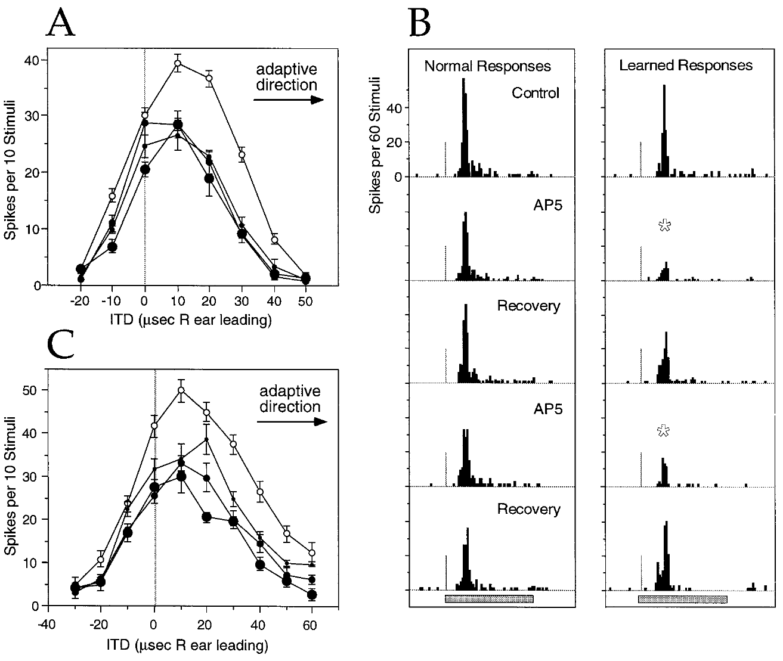
AP-5 preferentially reduces newly learned responses
Feldman and Knudsen compared normal and learned timing responses during local AP-5 application in ICX. NMDA names a glutamate receptor class identified by its sensitivity to N-methyl-D-aspartate, and AP-5 blocks the activation of that class. AP-5 was applied during the recording, so it acted on responses that had already formed. The drug therefore tested the expressed response.
In one transition-state example, the control best ITD had shifted 13 µs from the normal transect value. Responses to learned timing values were reduced preferentially during AP-5 ejection at 10–40 nA, while control and recovery responses confirmed reversibility. The tuning moved toward its normal component. The control shift served as a baseline for the drug effect.
The result supports a larger NMDA-receptor contribution to expression of newly learned responses. Because the drug was applied after those responses had formed, the experiment addresses expression rather than the induction of learning. The drug effect therefore reflects expression during the recording, not the original learning. Induction would require a drug applied before the learning occurred.
Feldman & Knudsen (1998), Fig. 5(A–C). AP-5 effects on transition-state tuning and spike timing.
Feldman & Knudsen (1998), Fig. 2(A). ICCls, ICX, and optic-tectum locations.
Feldman & Knudsen (1998)
22
Notes:
Teaching transcript:
Feldman and Knudsen compared normal and learned timing responses during local AP-5 application in ICX. NMDA names a class of glutamate receptor identified pharmacologically by N-methyl-D-aspartate sensitivity; AP-5 blocks its activation.
In a transition-state example, the control best ITD had shifted 13 µs from the normal transect value. Responses to learned timing values were preferentially reduced during AP-5 ejection at 10–40 nA, while control and recovery responses confirmed reversibility. The resulting tuning moved toward its normal component.
The result supports a greater NMDA-receptor contribution to expression of newly learned responses. Because the antagonist was applied after responses had developed, this experiment alone does not establish that NMDA receptors were necessary to induce the learning.
Expression is the ability of an established input to evoke a response during measurement. Induction is the process that originally changed the circuit; these are different causal questions.
References:
Daniel E. Feldman; Eric I. Knudsen (1998). Pharmacological Specialization of Learned Auditory Responses in the Inferior Colliculus of the Barn Owl. The Journal of Neuroscience 18(8):3073-3087. https://doi.org/10.1523/jneurosci.18-08-03073.1998
Feldman & Knudsen (1998), Fig. 5(A–C). AP-5 effects on transition-state tuning and spike timing.
Figure source: https://doi.org/10.1523/jneurosci.18-08-03073.1998
Feldman & Knudsen (1998), Fig. 2(A). ICCls, ICX, and optic-tectum locations.
Figure source: https://doi.org/10.1523/jneurosci.18-08-03073.1998

Slide 30
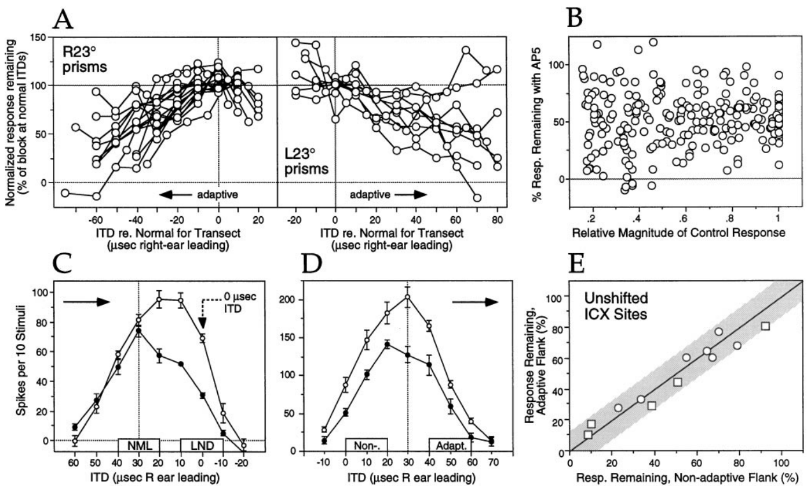
Drug sensitivity follows the learned timing component
A drug effect tied to one absolute ITD could mimic a selective effect on learning. Feldman and Knudsen therefore compared owls adapted in opposite directions and examined cases in which the learned response occurred near zero ITD. Opposite prism directions move the adaptive side of the tuning curve in opposite directions. The controls covered both flanks.
AP-5 sensitivity rose toward the adaptive side of the tuning curve in both prism directions. Preferential blockade also occurred when the learned response sat at 0 µs. The authors tested response magnitude and unshifted ICX sites as alternative explanations based on firing strength or stimulus timing. These sites matched the learned responses in timing but not in response strength.
These controls link pharmacology to the identity of the learned response rather than to the size of the spike. Experience therefore changes which inputs produce spikes, not merely the number of spikes that occur. The learned identity of a response is tied to its timing and to the circuit that produced it.
Feldman & Knudsen (1998), Fig. 7(A–E). Controls for response size and stimulus timing.
Feldman & Knudsen (1998), Fig. 2(A). ICCls, ICX, and optic-tectum locations.
Feldman & Knudsen (1998)
23
Notes:
Teaching transcript:
A drug effect tied to one absolute ITD could mimic a selective effect on learning. Feldman and Knudsen therefore compared owls adapted in opposite directions and examined cases where the learned response occurred near zero ITD.
AP-5 sensitivity increased toward the adaptive side of the tuning curve in both prism directions. Preferential blockade also occurred when the learned response was at 0 µs. The authors examined response magnitude and unshifted ICX sites to test alternative explanations based on firing strength or stimulus timing alone.
These controls support a relationship between pharmacology and learned response identity. They do not demonstrate that the neuron labels an input as learned. Experience changes the circuit properties that determine how different inputs generate spikes.
The adaptive direction reverses with prism direction. Selectivity that follows that reversal is stronger evidence than selectivity observed for only one physical stimulus range.
References:
Daniel E. Feldman; Eric I. Knudsen (1998). Pharmacological Specialization of Learned Auditory Responses in the Inferior Colliculus of the Barn Owl. The Journal of Neuroscience 18(8):3073-3087. https://doi.org/10.1523/jneurosci.18-08-03073.1998
Feldman & Knudsen (1998), Fig. 7(A–E). Controls for response size and stimulus timing.
Figure source: https://doi.org/10.1523/jneurosci.18-08-03073.1998
Feldman & Knudsen (1998), Fig. 2(A). ICCls, ICX, and optic-tectum locations.
Figure source: https://doi.org/10.1523/jneurosci.18-08-03073.1998

Slide 31
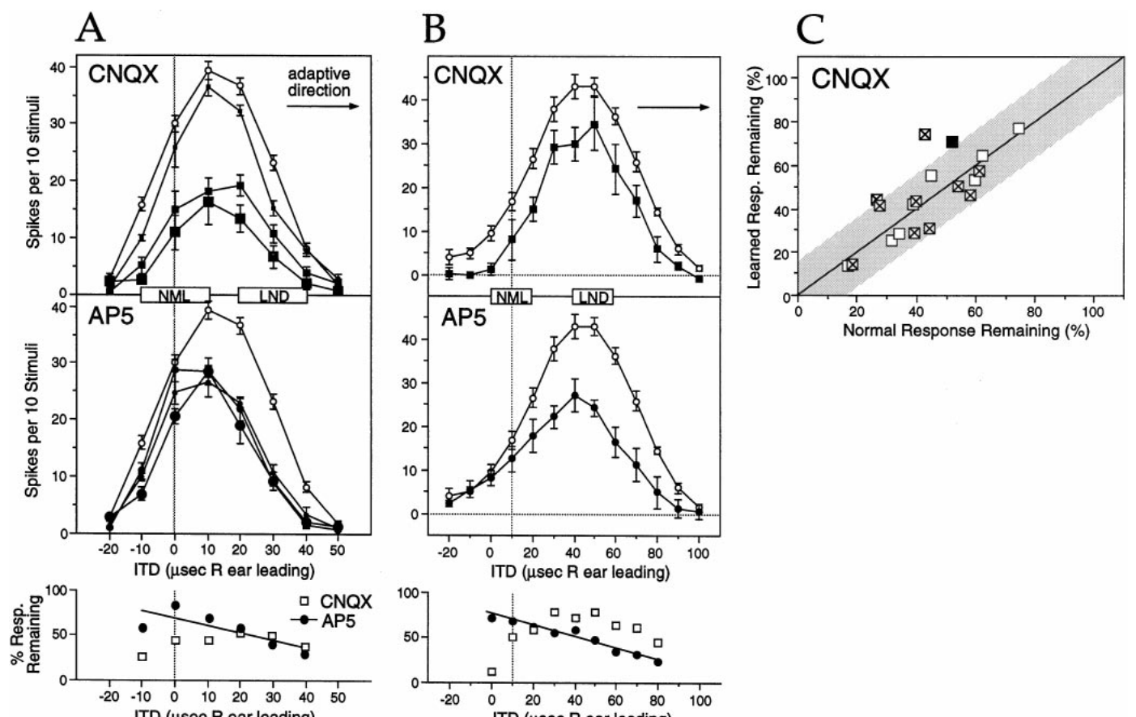
CNQX reduces both normal and learned responses
Non-NMDA receptors in this experiment are the glutamate receptor currents sensitive to CNQX, interpreted mainly as AMPA-mediated excitation. AMPA receptors contribute depolarization that helps convert auditory synaptic input into neuronal firing. In this experiment, non-NMDA receptors are identified by their CNQX sensitivity. Non-NMDA receptors are identified in this study by the drug that blocks them.
At transition-state ICX sites in owls with 30–154 days of prism experience, CNQX generally reduced normal and learned responses in similar proportion. At matched sites, AP-5 produced a preferential reduction of the learned side. The two drugs therefore produced contrasting effects. Equal CNQX blockade was observed at many transition-state sites in these owls.
Similar CNQX blockade of both components fits several receptor arrangements, since reducing non-NMDA depolarization also lowers the voltage-dependent contribution of NMDA receptors. The interpretation therefore depends on spike output rather than on isolated receptor currents. Blocking one current changes the response of the whole cell, and the drug result reflects that combined state.
Feldman & Knudsen (1998), Fig. 8(A–C). CNQX and AP-5 effects on transition-state tuning.
Feldman & Knudsen (1998), Fig. 2(A). ICCls, ICX, and optic-tectum locations.
Feldman & Knudsen (1998)
24
Notes:
Teaching transcript:
Non-NMDA receptors in this experiment refer to the glutamate receptor currents sensitive to CNQX, interpreted primarily as AMPA-mediated excitation. AMPA receptors contribute depolarization that helps convert auditory synaptic input into neuronal firing.
At transition-state ICX sites in owls with 30–154 days of prism experience, CNQX generally reduced normal and learned responses similarly. At matched sites, AP-5 could produce a preferential reduction on the learned side. The contrasting drug effects therefore did not reflect a universal tendency for every antagonist to suppress learned responses more strongly.
Equal CNQX blockade does not establish that normal and learned synapses contain identical receptor mixtures. Reducing non-NMDA depolarization can also reduce the voltage-dependent contribution of NMDA receptors, complicating a simple interpretation based on isolated receptor currents.
The measured endpoint is spikes. Interactions between excitatory receptor currents can make that endpoint differ from the effect of a blocker on one receptor class alone.
References:
Daniel E. Feldman; Eric I. Knudsen (1998). Pharmacological Specialization of Learned Auditory Responses in the Inferior Colliculus of the Barn Owl. The Journal of Neuroscience 18(8):3073-3087. https://doi.org/10.1523/jneurosci.18-08-03073.1998
Feldman & Knudsen (1998), Fig. 8(A–C). CNQX and AP-5 effects on transition-state tuning.
Figure source: https://doi.org/10.1523/jneurosci.18-08-03073.1998
Feldman & Knudsen (1998), Fig. 2(A). ICCls, ICX, and optic-tectum locations.
Figure source: https://doi.org/10.1523/jneurosci.18-08-03073.1998

Slide 32
Learned responses change their drug sensitivity
Expression is the ability of an established input to evoke a response during measurement. Induction is the process that originally changed the circuit. The two are different causal questions, and the drug result in this study addresses the first. The drug result reflects expression during the recording.
The adaptive direction reverses with prism direction. Selectivity that follows the reversal carries more weight than selectivity seen for a single stimulus range. Opposite prism directions give a test of the adaptive side. Owls adapted in opposite directions show the same reversal of selectivity.
Disinhibition is removal or reduction of inhibition. A weighted-average ITD summarizes the distribution of responses across timing values rather than identifying the strongest point alone. A distribution with a learned peak shifts the weighted value toward that peak. The weighted value reflects both peaks together.
Feldman & Knudsen (1998), Fig. 8(A–C). CNQX and AP-5 effects on transition-state tuning.
Feldman & Knudsen (1998), Fig. 2(A). ICCls, ICX, and optic-tectum locations.
Feldman & Knudsen (1998)
24a
Notes:
Learned responses change their drug sensitivity.
Explanation 1.
Expression is the ability of an established input to evoke a response during measurement
Induction is the process that originally changed the circuit. The two are different causal questions, and the drug result in this study addresses the first. The drug result reflects expression during the recording.
Explanation 2.
The adaptive direction reverses with prism direction
Selectivity that follows the reversal carries more weight than selectivity seen for a single stimulus range. Opposite prism directions give a test of the adaptive side. Owls adapted in opposite directions show the same reversal of selectivity.
Explanation 3.
Disinhibition is removal or reduction of inhibition
A weighted-average ITD summarizes the distribution of responses across timing values rather than identifying the strongest point alone. A distribution with a learned peak shifts the weighted value toward that peak. The weighted value reflects both peaks together.
Source.
The figure and its data come from Feldman & Knudsen (1998).
The full references are listed below.
References:
Daniel E. Feldman; Eric I. Knudsen (1998). Pharmacological Specialization of Learned Auditory Responses in the Inferior Colliculus of the Barn Owl. The Journal of Neuroscience 18(8):3073-3087. https://doi.org/10.1523/jneurosci.18-08-03073.1998

Slide 33
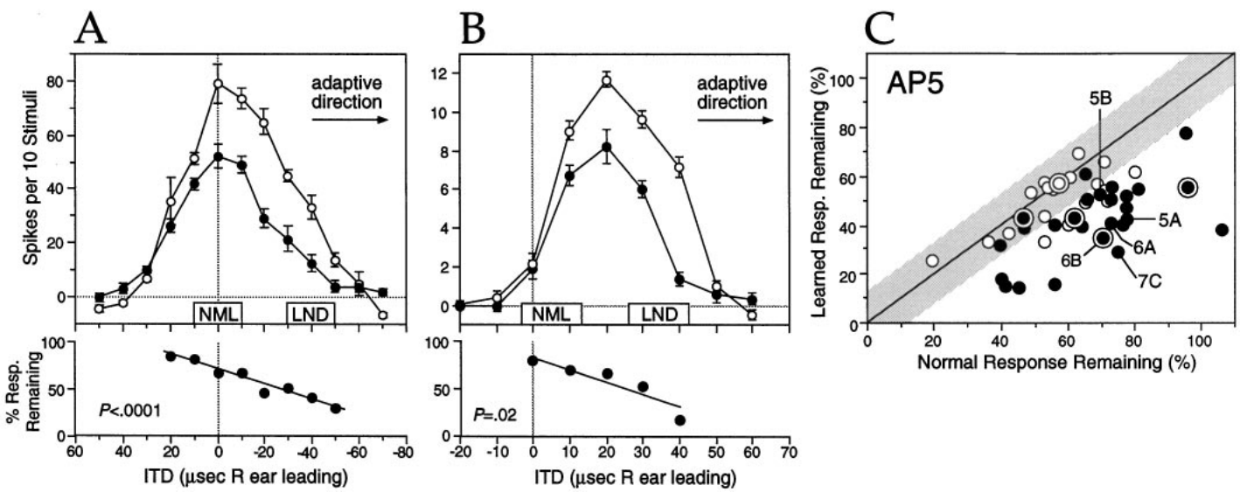
NMDA currents depend on synaptic and membrane state
NMDA-receptor currents depend on receptor activation and on the electrical state of the postsynaptic membrane. Depolarization makes the membrane voltage less negative and can increase the NMDA contribution to excitation. The membrane voltage therefore shapes how strongly NMDA receptors contribute during a response. This dependence is a property of the response.
Feldman and Knudsen's AP-5 experiments found that newly learned ICX responses were more sensitive than normal responses during 30–154 days of prism experience. Their interpretation allowed for changes intrinsic to the synapse and for changes in surrounding circuitry that altered the neuron's voltage during a response. Those changes were measured as spike responses.
Extracellular recordings measured spikes, not receptor numbers, receptor subunits, or the NMDA-to-AMPA current ratio. Those mechanisms are explanations consistent with the observed pharmacology, and the established result is differential dependence of the spike response on NMDA-receptor activation. Receptor activation is therefore inferred from pharmacology. The spike response is the measured outcome in these experiments.
Feldman & Knudsen (1998), Fig. 6(A–C). Functional NMDA sensitivity of learned responses.
Feldman & Knudsen (1998), Fig. 2(A). ICCls, ICX, and optic-tectum locations.
Feldman & Knudsen (1998)
25
Notes:
Teaching transcript:
NMDA-receptor currents depend on receptor activation and on the postsynaptic membrane’s electrical state. A postsynaptic neuron receives a synaptic input; depolarization makes its membrane voltage less negative and can increase the contribution of NMDA currents to excitation.
Feldman and Knudsen’s AP-5 experiments found greater sensitivity of newly learned ICX responses than of normal responses during 30–154 days of prism experience. Their interpretation allowed changes intrinsic to the synapse and changes in the surrounding circuit that altered the neuron’s voltage during a response.
The extracellular recordings did not directly measure receptor numbers, receptor subunits, or the NMDA-to-AMPA current ratio. Those mechanisms remain explanations consistent with the observed pharmacology. The established result is differential dependence of the spike response on NMDA-receptor activation.
The paper discusses voltage dependence as one reason that antagonist sensitivity cannot uniquely reveal receptor abundance. Mechanistic alternatives must remain distinct from the measured drug effect.
References:
Daniel E. Feldman; Eric I. Knudsen (1998). Pharmacological Specialization of Learned Auditory Responses in the Inferior Colliculus of the Barn Owl. The Journal of Neuroscience 18(8):3073-3087. https://doi.org/10.1523/jneurosci.18-08-03073.1998
Feldman & Knudsen (1998), Fig. 6(A–C). Functional NMDA sensitivity of learned responses.
Figure source: https://doi.org/10.1523/jneurosci.18-08-03073.1998
Feldman & Knudsen (1998), Fig. 2(A). ICCls, ICX, and optic-tectum locations.
Figure source: https://doi.org/10.1523/jneurosci.18-08-03073.1998

Slide 34
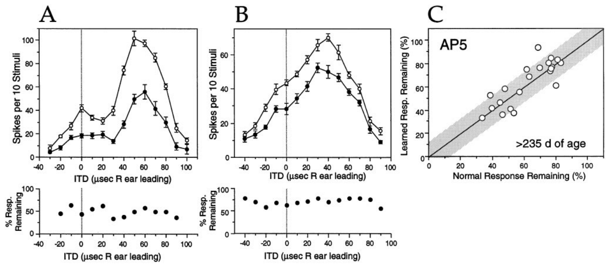
Learned-response pharmacology changes with experience
A newly acquired response may not keep its original receptor dependence. Feldman and Knudsen tested ICX sites after more than 175 days of prism experience, when the shifted auditory tuning had been established for a long period. The change arises after a prolonged period in which the new map was expressed. The recordings came late in the experiment.
AP-5 no longer blocked learned responses preferentially. Examples from owls with 259 and 386 days of experience showed a more uniform reduction across the tuning curve. Normal response components were still measurable at the same sites. The uniform reduction contrasts with the earlier preferential effect at younger ages, which were tested at shorter exposures.
The change is consistent with maturation of the circuit that supports learned responses. The drug still reduced auditory firing, so NMDA-receptor contributions persisted, and the change concerns differential sensitivity between normal and learned inputs. Receptor activation stayed part of the response. Maturation of the circuit may explain why the learned response changed its drug sensitivity.
Feldman & Knudsen (1998), Fig. 9(A–C). AP-5 effects after extended prism experience.
Feldman & Knudsen (1998), Fig. 2(A). ICCls, ICX, and optic-tectum locations.
Feldman & Knudsen (1998)
26
Notes:
Teaching transcript:
A newly acquired response need not retain its initial receptor dependence. Feldman and Knudsen tested ICX sites after more than 175 days of prism experience, when shifted auditory tuning had been established for a prolonged period.
AP-5 no longer preferentially blocked learned responses. Examples from owls with 259 and 386 days of experience showed more uniform reduction across the tuning curve. Normal response components remained measurable at the sites used for the within-site comparison.
The change is consistent with maturation of the circuit supporting learned responses. It does not mean NMDA receptors disappear: the drug still reduced auditory firing. The observation concerns loss of differential sensitivity between normal and learned inputs, rather than loss of every NMDA contribution.
An equal drug effect on two response components can emerge from changes in one component. It should not be interpreted as proof that both components changed equally.
References:
Daniel E. Feldman; Eric I. Knudsen (1998). Pharmacological Specialization of Learned Auditory Responses in the Inferior Colliculus of the Barn Owl. The Journal of Neuroscience 18(8):3073-3087. https://doi.org/10.1523/jneurosci.18-08-03073.1998
Feldman & Knudsen (1998), Fig. 9(A–C). AP-5 effects after extended prism experience.
Figure source: https://doi.org/10.1523/jneurosci.18-08-03073.1998
Feldman & Knudsen (1998), Fig. 2(A). ICCls, ICX, and optic-tectum locations.
Figure source: https://doi.org/10.1523/jneurosci.18-08-03073.1998

Slide 35
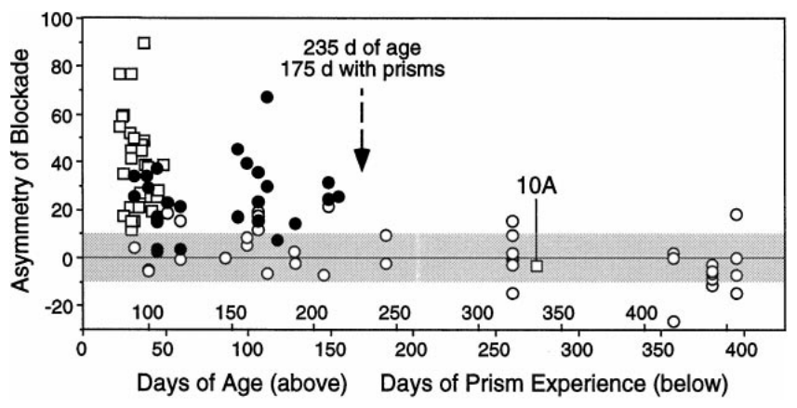
Age and experience duration are confounded
Learning-associated pharmacology changes over a timescale that overlaps development. Feldman and Knudsen plotted differential AP-5 blockade against both age and the number of days spent wearing prisms. Age and experience changed together across the recorded animals. The number of days wearing prisms is one measure of experience, while age is a different measure.
The preferential effect on learned responses was absent after roughly 235 days of age, corresponding to about 175 days of prism experience in this preparation. Because prisms were generally attached at similar ages, older animals also had longer exposure. Owls of different ages therefore differ in both age and the length of their prism exposure.
Chronological maturation, continued sensory experience, or both could account for the change. Proposed shifts in AMPA or NMDA contributions, or in inhibition, would be tested separately, so the correlation is not a definitive developmental switch. The results describe a relationship between two correlated variables. Age and exposure are entangled in these data, so each effect is hard to isolate.
Feldman & Knudsen (1998), Fig. 11. AP-5 asymmetry versus age and prism experience.
Feldman & Knudsen (1998), Fig. 2(A). ICCls, ICX, and optic-tectum locations.
Feldman & Knudsen (1998)
27
Notes:
Teaching transcript:
Learning-associated pharmacology changes over a timescale that overlaps development. Feldman and Knudsen plotted differential AP-5 blockade against both age and the number of days wearing prisms, retaining the relationship between these two variables.
The preferential effect on learned responses was absent after roughly 235 days of age, corresponding to about 175 days of prism experience in this preparation. Because prisms were generally attached at similar ages, older animals also had longer exposure.
The study therefore cannot determine whether chronological maturation, continued sensory experience, or both caused the change. A proposed increase in AMPA contribution, decrease in NMDA contribution, or altered inhibition requires further evidence. The measured correlation should not be converted into a definitive developmental switch.
Separating age from experience would require animals of comparable age with different exposure histories, or comparable exposure durations beginning at different ages.
References:
Daniel E. Feldman; Eric I. Knudsen (1998). Pharmacological Specialization of Learned Auditory Responses in the Inferior Colliculus of the Barn Owl. The Journal of Neuroscience 18(8):3073-3087. https://doi.org/10.1523/jneurosci.18-08-03073.1998
Feldman & Knudsen (1998), Fig. 11. AP-5 asymmetry versus age and prism experience.
Figure source: https://doi.org/10.1523/jneurosci.18-08-03073.1998
Feldman & Knudsen (1998), Fig. 2(A). ICCls, ICX, and optic-tectum locations.
Figure source: https://doi.org/10.1523/jneurosci.18-08-03073.1998

Slide 36
Pharmacology tracks age and exposure together
Voltage dependence is one reason antagonist sensitivity fails to reveal receptor abundance directly. Mechanistic alternatives remain distinct from the measured drug effect. The drug effect is a measured quantity, while the mechanism behind it is an inference. Mechanisms such as AMPA or NMDA changes are candidate explanations.
Spikes are the measured endpoint here, and interactions among excitatory currents can shift that endpoint away from the effect of a single blocker. Blocking one receptor class has consequences that extend beyond that class. The response measured in these recordings is the spike, not the receptor. Interactions in the cell determine how these currents combine.
What matters for map expression is the relation between inhibitory tuning and the competing excitatory inputs. That relation is the quantity the drug experiments track. Inhibitory tuning can differ from excitatory tuning at the same site. Competing inputs set the weighting, and weighting sets the expressed timing preference.
Feldman & Knudsen (1998), Fig. 11. AP-5 asymmetry versus age and prism experience.
Feldman & Knudsen (1998), Fig. 2(A). ICCls, ICX, and optic-tectum locations.
Feldman & Knudsen (1998)
27a
Notes:
Pharmacology tracks age and exposure together.
Explanation 1.
Voltage dependence is one reason antagonist sensitivity fails to reveal receptor abundance directly
Mechanistic alternatives remain distinct from the measured drug effect. The drug effect is a measured quantity, while the mechanism behind it is an inference. Mechanisms such as AMPA or NMDA changes are candidate explanations.
Explanation 2.
Spikes are the measured endpoint here, and interactions among excitatory currents can shift that endpoint away from the effect of a single blocker
Blocking one receptor class has consequences that extend beyond that class. The response measured in these recordings is the spike, not the receptor. Interactions in the cell determine how these currents combine.
Explanation 3.
What matters for map expression is the relation between inhibitory tuning and the competing excitatory inputs
That relation is the quantity the drug experiments track. Inhibitory tuning can differ from excitatory tuning at the same site. Competing inputs set the weighting, and weighting sets the expressed timing preference.
Source.
The figure and its data come from Feldman & Knudsen (1998).
The full references are listed below.
References:
Daniel E. Feldman; Eric I. Knudsen (1998). Pharmacological Specialization of Learned Auditory Responses in the Inferior Colliculus of the Barn Owl. The Journal of Neuroscience 18(8):3073-3087. https://doi.org/10.1523/jneurosci.18-08-03073.1998

Slide 37
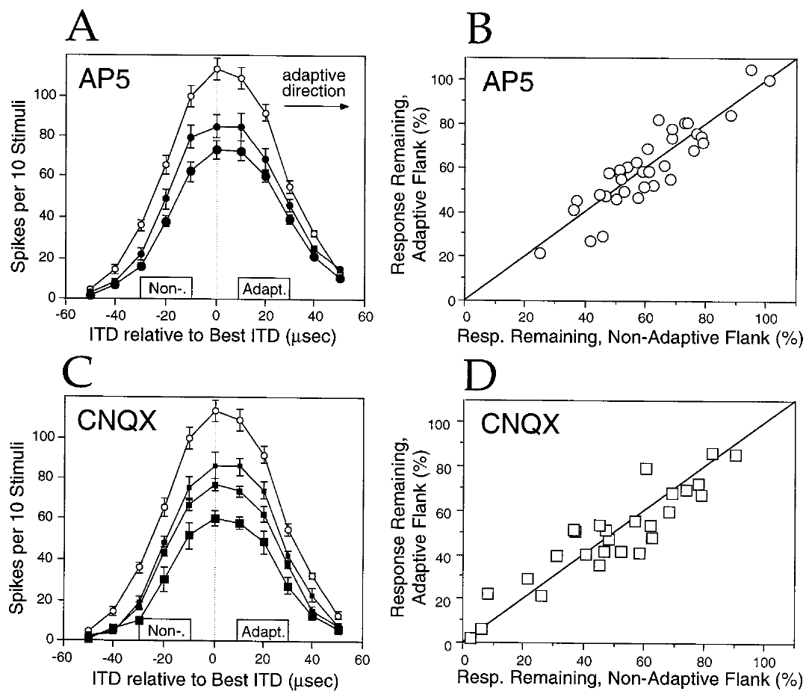
Upstream responses lack the learned pharmacological bias
The lateral shell of ICC, called ICCls, provides timing-specific input to ICX. Feldman and Knudsen asked whether the pharmacological asymmetry of learned responses was inherited from this upstream representation. Answering that question required recordings from ICCls itself. Its timing signal reaches ICX directly, which makes it the immediate upstream source.
In prism-reared owls, AP-5 and CNQX generally reduced the adaptive and nonadaptive flanks of ICCls tuning similarly. Ejection currents were varied at each site, and the direction of the downstream ICX adjustment supplied the adaptive reference. These recordings contrast with the preferential AP-5 effect on learned ICX responses. Both drugs were tested at each site.
The distinctive learned-response pharmacology therefore appears downstream of the tested ICCls responses. The experiments sampled particular sites and measured spikes, so the conclusion is a localized difference in the tested functional response. The asymmetry was seen in ICX but not in the ICCls recordings examined here. Both observations come from the same prism-reared animals.
Feldman & Knudsen (1998), Fig. 4(A–D). AP-5 and CNQX effects in prism-reared ICCls.
Feldman & Knudsen (1998), Fig. 2(A). ICCls, ICX, and optic-tectum locations.
Feldman & Knudsen (1998)
28
Notes:
Teaching transcript:
The lateral shell of ICC, called ICCls, provides timing-specific input to ICX. Feldman and Knudsen tested whether the pharmacological asymmetry of learned responses was inherited from this upstream representation.
In prism-reared owls, AP-5 and CNQX generally reduced the adaptive and nonadaptive flanks of ICCls tuning similarly. Ejection currents were varied, and the direction of the downstream ICX adjustment provided the adaptive reference. These recordings contrasted with the preferential AP-5 effect on learned ICX responses.
The comparison places the distinctive expression of learned-response pharmacology downstream of the tested ICCls responses. It does not exclude every possible upstream change, because the experiments sampled particular sites and measured spikes rather than all presynaptic inputs. The conclusion is a localized difference in the tested functional response.
An adaptive flank is the side of a tuning curve toward the ITD values instructed by the prism displacement. It is defined by the animal’s experimental condition.
References:
Daniel E. Feldman; Eric I. Knudsen (1998). Pharmacological Specialization of Learned Auditory Responses in the Inferior Colliculus of the Barn Owl. The Journal of Neuroscience 18(8):3073-3087. https://doi.org/10.1523/jneurosci.18-08-03073.1998
Feldman & Knudsen (1998), Fig. 4(A–D). AP-5 and CNQX effects in prism-reared ICCls.
Figure source: https://doi.org/10.1523/jneurosci.18-08-03073.1998
Feldman & Knudsen (1998), Fig. 2(A). ICCls, ICX, and optic-tectum locations.
Figure source: https://doi.org/10.1523/jneurosci.18-08-03073.1998

Slide 38
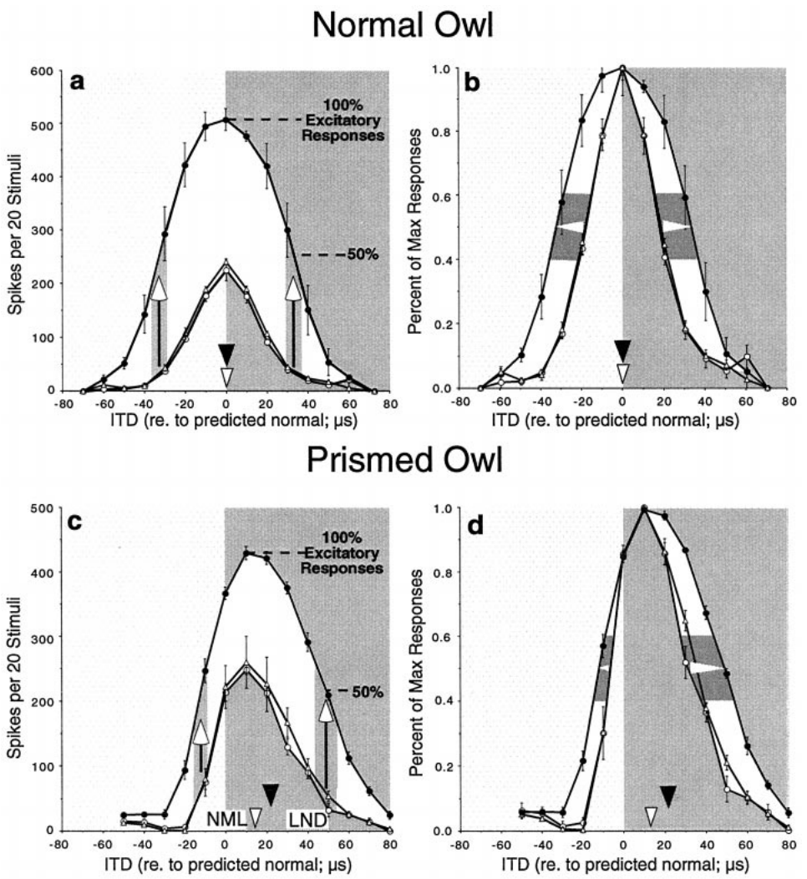
GABAergic inhibition limits expression of excitation
GABA, or gamma-aminobutyric acid, mediates the inhibitory input studied in Zheng and Knudsen's ICX experiments. GABA-A receptors are the receptor type blocked by bicuculline, so reducing their action tests how inhibition shapes spike responses to auditory excitation. Blocking them removes one source of inhibitory input to the recorded neurons. Bicuculline blocks the GABA-A receptor, which is one class of inhibitory receptor.
In a normal owl, bicuculline increased responses while leaving the weighted timing preference nearly unchanged. During early prism adaptation, the same manipulation could shift the response toward learned ITDs. Control, drug, and recovery periods linked these changes to reversible local application. The weighted timing preference is a summary of the response across many timing values.
A response revealed by disinhibition was already supported by functional excitatory input. The drug did not need to create a new projection during the session, so inhibition masks the timing information that excitation already carries. Inhibition determines which excitatory timing inputs appear in the recorded spikes. The weighted timing preference summarizes that distribution.
Zheng & Knudsen (2001), Fig. 2(a–d). Bicuculline effects in normal and adapting ICX.
Feldman & Knudsen (1998), Fig. 2(A). ICCls, ICX, and optic-tectum locations.
Zheng & Knudsen (2001)
29
Notes:
Teaching transcript:
GABA, gamma-aminobutyric acid, mediates inhibitory input in the ICX experiments of Zheng and Knudsen. GABAA receptors are the receptor class blocked by bicuculline. Reducing their action tests how inhibition shapes the spike responses generated by auditory excitation.
In a normal owl, bicuculline increased responses while leaving the weighted timing preference approximately unchanged. During early prism adaptation, the same manipulation could shift the response toward learned ITDs. Control, drug, and recovery periods linked these changes to reversible local application.
A response revealed by disinhibition was already supported by functional excitatory input. The drug did not need to create a new projection during the recording session. The result separates the available excitatory information from the timing information expressed in spikes when inhibition is active.
Disinhibition is removal or reduction of inhibition. A weighted-average ITD summarizes the distribution of responses across timing values rather than identifying only the strongest point.
References:
Weimin Zheng; Eric I. Knudsen (2001). GABAergic Inhibition Antagonizes Adaptive Adjustment of the Owl's Auditory Space Map during the Initial Phase of Plasticity. The Journal of Neuroscience 21(12):4356-4365. https://doi.org/10.1523/jneurosci.21-12-04356.2001
Daniel E. Feldman; Eric I. Knudsen (1998). Pharmacological Specialization of Learned Auditory Responses in the Inferior Colliculus of the Barn Owl. The Journal of Neuroscience 18(8):3073-3087. https://doi.org/10.1523/jneurosci.18-08-03073.1998
Zheng & Knudsen (2001), Fig. 2(a–d). Bicuculline effects in normal and adapting ICX.
Figure source: https://doi.org/10.1523/jneurosci.21-12-04356.2001
Feldman & Knudsen (1998), Fig. 2(A). ICCls, ICX, and optic-tectum locations.
Figure source: https://doi.org/10.1523/jneurosci.18-08-03073.1998

Slide 39
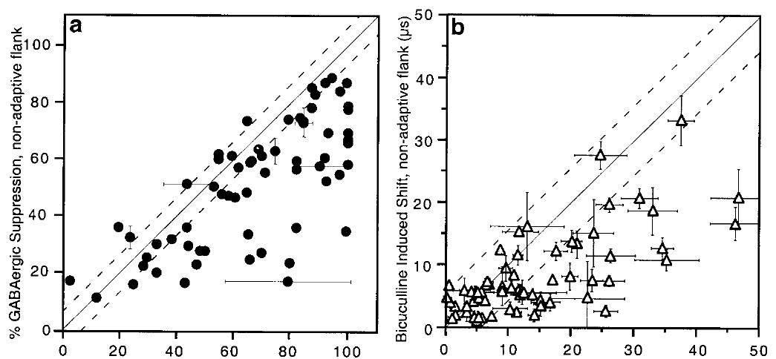
Early inhibition preferentially masks learned inputs
Early adaptive excitation can remain partly hidden by inhibition. Zheng and Knudsen compared bicuculline-induced changes on the adaptive and nonadaptive sides of ICX tuning curves in prism-wearing and normal owls. Inhibition therefore affects which timing values reach spike output. Responses on both sides of the tuning curve were measured at each site.
During the initial phase, GABAergic inhibition suppressed the learned side more strongly. At a representative site, removing inhibition shifted the weighted preference from about 13 to 21 µs in the adaptive direction. Recovery returned the preference toward its pre-drug value. The adaptive side of the tuning curve was the one that showed the stronger inhibitory suppression.
The extra adaptive shift shows that the excitatory circuit had changed more than ordinary spike tuning revealed. Inhibition therefore opposed expression of the new mapping at this stage, and some adaptive excitation had already formed. That excitation was revealed when inhibition was removed. The excitatory circuit had changed before the spike response showed it.
Zheng & Knudsen (2001), Fig. 3(a–b). Asymmetric suppression during initial map adjustment.
Feldman & Knudsen (1998), Fig. 2(A). ICCls, ICX, and optic-tectum locations.
Zheng & Knudsen (2001)
30
Notes:
Teaching transcript:
Early adaptive excitation can remain partly hidden by inhibition. Zheng and Knudsen compared bicuculline-induced changes on the adaptive and nonadaptive sides of ICX tuning curves in prism-wearing and normal owls.
During the initial phase, GABAergic inhibition suppressed the learned side more strongly. At a representative site, removing inhibition shifted the weighted preference from approximately 13 to 21 µs in the adaptive direction. Recovery restored the preference toward its pre-drug value.
The additional adaptive shift means that the excitatory circuit had changed more than the ordinary spike tuning revealed. Inhibition therefore opposed expression of the new mapping at this stage. This does not establish that inhibition prevented every underlying learning event; the revealed response indicates that some adaptive excitation had already formed.
The asymmetric effect concerns which timing inputs are suppressed, not simply how much total firing increases when an inhibitory receptor is blocked.
References:
Weimin Zheng; Eric I. Knudsen (2001). GABAergic Inhibition Antagonizes Adaptive Adjustment of the Owl's Auditory Space Map during the Initial Phase of Plasticity. The Journal of Neuroscience 21(12):4356-4365. https://doi.org/10.1523/jneurosci.21-12-04356.2001
Daniel E. Feldman; Eric I. Knudsen (1998). Pharmacological Specialization of Learned Auditory Responses in the Inferior Colliculus of the Barn Owl. The Journal of Neuroscience 18(8):3073-3087. https://doi.org/10.1523/jneurosci.18-08-03073.1998
Zheng & Knudsen (2001), Fig. 3(a–b). Asymmetric suppression during initial map adjustment.
Figure source: https://doi.org/10.1523/jneurosci.21-12-04356.2001
Feldman & Knudsen (1998), Fig. 2(A). ICCls, ICX, and optic-tectum locations.
Figure source: https://doi.org/10.1523/jneurosci.18-08-03073.1998

Slide 40
Expressed responses depend on competing inputs
Normal and learned components are defined by stimulus timing and the anatomical reference. Their inhibitory and excitatory pharmacology may develop at different rates. The stimulus timing sets which values count as learned. The anatomical reference marks the normal timing that the learned values depart from.
The asymmetric effect concerns which timing inputs are suppressed. It is not simply how much total firing increases when an inhibitory receptor is blocked. A functional bias can reverse without inhibition becoming globally stronger or weaker. Inhibition is a distinct input from the excitatory timing values it modifies.
A tuning curve records neuronal response across stimulus values. Its preferred value and its width describe different properties of the response. A broad curve and a narrow curve can share the same preferred value. The curve's shape is informative beyond its peak. Shape and peak together describe the expressed response.
Zheng & Knudsen (2001), Fig. 3(a–b). Asymmetric suppression during initial map adjustment.
Feldman & Knudsen (1998), Fig. 2(A). ICCls, ICX, and optic-tectum locations.
Zheng & Knudsen (2001)
30a
Notes:
Expressed responses depend on competing inputs.
Explanation 1.
Normal and learned components are defined by stimulus timing and the anatomical reference
Their inhibitory and excitatory pharmacology may develop at different rates. The stimulus timing sets which values count as learned. The anatomical reference marks the normal timing that the learned values depart from.
Explanation 2.
The asymmetric effect concerns which timing inputs are suppressed
It is not simply how much total firing increases when an inhibitory receptor is blocked. A functional bias can reverse without inhibition becoming globally stronger or weaker. Inhibition is a distinct input from the excitatory timing values it modifies.
Explanation 3.
A tuning curve records neuronal response across stimulus values
Its preferred value and its width describe different properties of the response. A broad curve and a narrow curve can share the same preferred value. The curve's shape is informative beyond its peak. Shape and peak together describe the expressed response.
Source.
The figure and its data come from Zheng & Knudsen (2001).
The full references are listed below.
References:
Weimin Zheng; Eric I. Knudsen (2001). GABAergic Inhibition Antagonizes Adaptive Adjustment of the Owl's Auditory Space Map during the Initial Phase of Plasticity. The Journal of Neuroscience 21(12):4356-4365. https://doi.org/10.1523/jneurosci.21-12-04356.2001

Slide 41
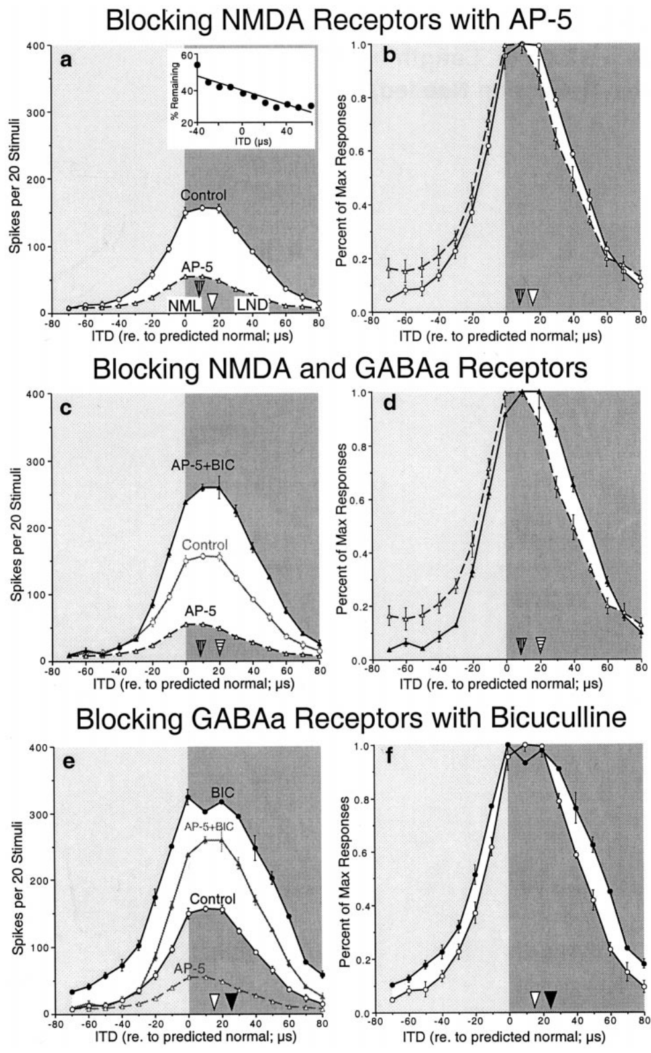
NMDA blockade does not remove inhibitory asymmetry
A voltage-dependent interaction between excitation and inhibition could potentially explain an asymmetric bicuculline effect. Zheng and Knudsen tested this by blocking NMDA receptors with AP-5 while measuring the effect of removing GABA-A-mediated inhibition. AP-5 and bicuculline were applied in sequence at the same site. The sequence matters because each step changes the preparation.
At an ICX site with preferential NMDA support for learned responses, AP-5 shifted weighted tuning about 8 µs in the nonadaptive direction. Adding bicuculline still revealed an asymmetric increase toward adaptive timing values. The disinhibitory effect persisted when NMDA-receptor activation was reduced. Blocking NMDA receptors did not remove the asymmetry.
The result indicates that learned-side suppression was not merely an indirect consequence of NMDA voltage dependence, and it supports an ITD-specific inhibitory influence. The inhibitory neuron itself, and its connection to the recorded population, are still to be identified. The inhibitory influence was measured on the expressed timing values at this site.
Feldman & Knudsen (1998), Fig. 2(A). ICCls, ICX, and optic-tectum locations.
Zheng & Knudsen (2001)
31
Notes:
Teaching transcript:
A voltage-dependent interaction between excitation and inhibition could potentially explain an asymmetric bicuculline effect. Zheng and Knudsen tested this possibility by blocking NMDA receptors with AP-5 while measuring the effect of removing GABAA-mediated inhibition.
At an ICX site with preferential NMDA support for learned responses, AP-5 shifted weighted tuning about 8 µs in the nonadaptive direction. Adding bicuculline nevertheless revealed an asymmetric increase toward adaptive timing values. The disinhibitory effect therefore persisted when NMDA-receptor activation was reduced.
The result argues that the learned-side suppression was not merely an indirect consequence of NMDA voltage dependence. It supports an ITD-specific inhibitory influence. It does not directly identify the inhibitory neuron or demonstrate the anatomy of its connection to the recorded population.
Sequential receptor blockade compares excitation and inhibition within the same local preparation. The surviving effect is evidence against a mechanism requiring the blocked receptor contribution.
References:
Weimin Zheng; Eric I. Knudsen (2001). GABAergic Inhibition Antagonizes Adaptive Adjustment of the Owl's Auditory Space Map during the Initial Phase of Plasticity. The Journal of Neuroscience 21(12):4356-4365. https://doi.org/10.1523/jneurosci.21-12-04356.2001
Daniel E. Feldman; Eric I. Knudsen (1998). Pharmacological Specialization of Learned Auditory Responses in the Inferior Colliculus of the Barn Owl. The Journal of Neuroscience 18(8):3073-3087. https://doi.org/10.1523/jneurosci.18-08-03073.1998
Zheng & Knudsen (2001), Fig. 4(a–f). Sequential AP-5 and bicuculline effects.
Figure source: https://doi.org/10.1523/jneurosci.21-12-04356.2001
Feldman & Knudsen (1998), Fig. 2(A). ICCls, ICX, and optic-tectum locations.
Figure source: https://doi.org/10.1523/jneurosci.18-08-03073.1998

Slide 42
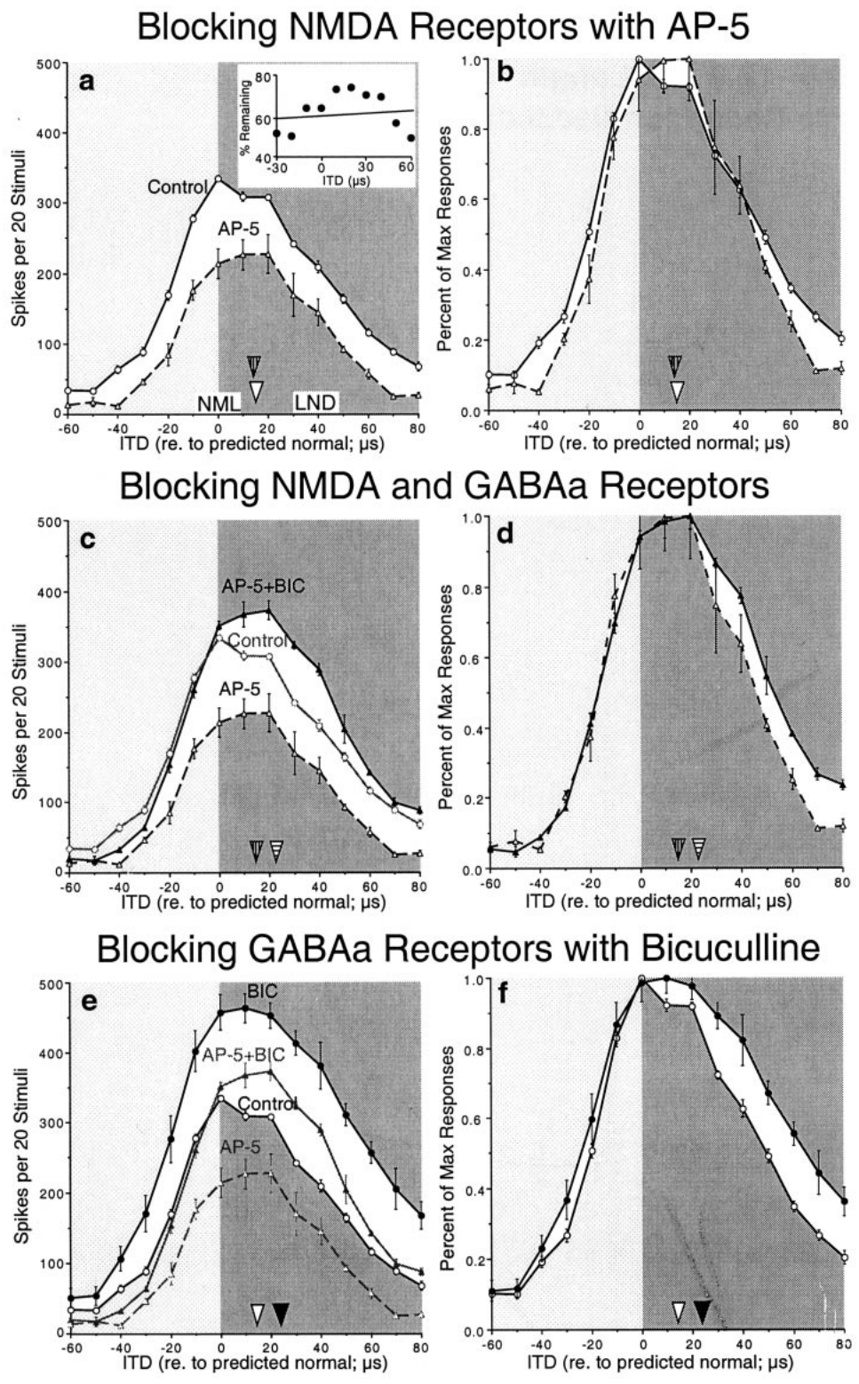
Inhibitory bias can occur without selective NMDA support
Not every adapting ICX site shows greater NMDA dependence for learned responses. Zheng and Knudsen examined a site where AP-5 reduced normal and learned responses similarly and left the weighted timing preference unchanged. Uniform AP-5 effects at this site contrast with the preferential effect at other sites. Equal drug effects at one site indicate a different pattern from the NMDA-dependent sites.
Bicuculline still produced a larger increase on the adaptive side of the tuning curve, including when NMDA receptors were blocked. Selective GABAergic suppression of learned timing inputs can therefore exist without a matching selective AP-5 effect at that site. Disinhibition at this site still produced an asymmetric increase toward the adaptive timing values.
The two pharmacological properties are separable in these recordings, because inhibitory bias can be detected where NMDA sensitivity is uniform. The measurement concerns expressed input weighting rather than receptor placement on identified synapses. Inhibitory input and NMDA sensitivity can vary independently across sites. A site with uniform AP-5 effects still showed a larger adaptive increase.
Feldman & Knudsen (1998), Fig. 2(A). ICCls, ICX, and optic-tectum locations.
Zheng & Knudsen (2001)
32
Notes:
Teaching transcript:
Not every adapting ICX site exhibits greater NMDA dependence for learned responses. Zheng and Knudsen examined a site where AP-5 reduced normal and learned responses similarly and did not shift the weighted timing preference.
Bicuculline still produced a greater increase on the adaptive side of the tuning curve, including when NMDA receptors were blocked. Thus, selective GABAergic suppression of learned timing inputs could exist without a corresponding selective AP-5 effect at that recording site.
The two pharmacological properties are therefore separable. Differential inhibition cannot be inferred solely from the presence of differential NMDA sensitivity, and absence of the latter does not establish absence of the former. The experiment concerns expressed input weighting, not a direct measurement of receptor placement on identified synapses.
Normal and learned components are defined by stimulus timing and the anatomical reference. Their inhibitory and excitatory pharmacology need not mature at identical rates.
References:
Weimin Zheng; Eric I. Knudsen (2001). GABAergic Inhibition Antagonizes Adaptive Adjustment of the Owl's Auditory Space Map during the Initial Phase of Plasticity. The Journal of Neuroscience 21(12):4356-4365. https://doi.org/10.1523/jneurosci.21-12-04356.2001
Daniel E. Feldman; Eric I. Knudsen (1998). Pharmacological Specialization of Learned Auditory Responses in the Inferior Colliculus of the Barn Owl. The Journal of Neuroscience 18(8):3073-3087. https://doi.org/10.1523/jneurosci.18-08-03073.1998
Zheng & Knudsen (2001), Fig. 5(a–f). Disinhibition at a site with uniform AP-5 effects.
Figure source: https://doi.org/10.1523/jneurosci.21-12-04356.2001
Feldman & Knudsen (1998), Fig. 2(A). ICCls, ICX, and optic-tectum locations.
Figure source: https://doi.org/10.1523/jneurosci.18-08-03073.1998

Slide 43
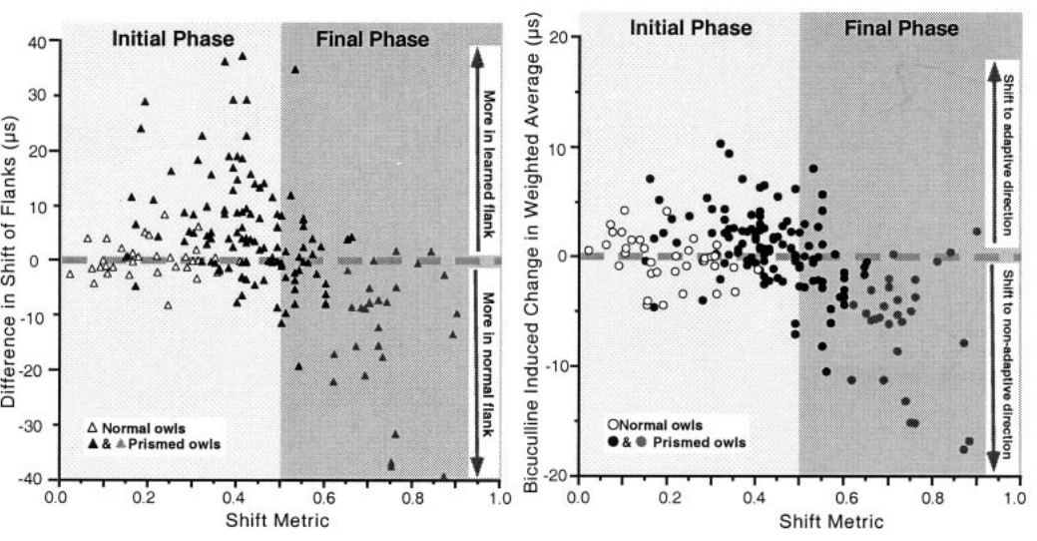
Inhibition changes its bias as the map consolidates
The influence of inhibition depends on the stage of auditory-map adaptation. Zheng and Knudsen compared bicuculline's effects during early adjustment, established adjustment, and normal auditory maps. Each stage was characterized by its own pattern of bicuculline sensitivity. The three stages differed in which timing inputs were suppressed in these experiments.
During the initial phase, disinhibition favored learned timing values. At later stages, inhibition preferentially suppressed the original normal inputs, which helped the learned mapping dominate expressed tuning. Both stages involved an inhibitory contribution, but its timing selectivity differed. The inhibitory contribution shifted with the stage of adaptation in these recordings.
The relationship between excitation and inhibition changes across the course of adaptation. A plausible explanation is that inhibitory connectivity adjusts differently from adaptive excitation, a sequence inferred from measurements taken across conditions. The stages were sampled at different points, so each one reflects its own condition across the three stages.
Zheng & Knudsen (2001), Fig. 7(a–b). Inhibitory effects across stages of map adjustment.
Feldman & Knudsen (1998), Fig. 2(A). ICCls, ICX, and optic-tectum locations.
Zheng & Knudsen (2001)
33
Notes:
Teaching transcript:
The influence of inhibition depends on the stage of auditory-map adaptation. Zheng and Knudsen compared the effects of bicuculline across early adjustment, established adjustment, and normal auditory maps.
During the initial phase, disinhibition favored learned timing values. At later stages represented in the comparison, inhibition preferentially suppressed the original normal inputs, helping the learned mapping dominate expressed tuning. Both stages involved an inhibitory contribution, but its timing selectivity differed.
These observations support a changing relationship between excitatory and inhibitory input. The proposed explanation is that inhibitory connectivity adjusts differently from adaptive excitation. The recordings do not directly follow the same inhibitory synapse from one stage to another, so the developmental sequence is inferred from measurements across conditions.
A functional bias can reverse without inhibition becoming globally stronger or weaker. What matters for map expression is the relation between inhibitory tuning and the competing excitatory inputs.
References:
Weimin Zheng; Eric I. Knudsen (2001). GABAergic Inhibition Antagonizes Adaptive Adjustment of the Owl's Auditory Space Map during the Initial Phase of Plasticity. The Journal of Neuroscience 21(12):4356-4365. https://doi.org/10.1523/jneurosci.21-12-04356.2001
Daniel E. Feldman; Eric I. Knudsen (1998). Pharmacological Specialization of Learned Auditory Responses in the Inferior Colliculus of the Barn Owl. The Journal of Neuroscience 18(8):3073-3087. https://doi.org/10.1523/jneurosci.18-08-03073.1998
Zheng & Knudsen (2001), Fig. 7(a–b). Inhibitory effects across stages of map adjustment.
Figure source: https://doi.org/10.1523/jneurosci.21-12-04356.2001
Feldman & Knudsen (1998), Fig. 2(A). ICCls, ICX, and optic-tectum locations.
Figure source: https://doi.org/10.1523/jneurosci.18-08-03073.1998

Slide 44
Inhibition shapes the expressed weighting
Sequential blockade measures excitation and inhibition within one local preparation. A surviving effect argues against a mechanism that depends on the blocked receptor. That logic was applied to the NMDA receptor in these recordings. A blocker of one receptor type is applied first, and the second blocker follows.
Inhibitory bias at one site can exist with or without a matching NMDA bias. The bias is measured in expressed timing values, not in total firing. A site can show uniform AP-5 effects and still display an adaptive increase when inhibition is removed. At such a site, the disinhibition effect appears in the expressed timing values.
The recordings follow no single inhibitory synapse across stages. Each stage is a sample of the circuit at one moment, not a tracked synapse. The bias changes as the map is reorganized, and the stages sample that change at a few points. Expressed weighting is a property of the whole inhibitory and excitatory balance.
Zheng & Knudsen (2001), Fig. 7(a–b). Inhibitory effects across stages of map adjustment.
Feldman & Knudsen (1998), Fig. 2(A). ICCls, ICX, and optic-tectum locations.
Zheng & Knudsen (2001)
33a
Notes:
Inhibition shapes the expressed weighting.
Explanation 1.
Sequential blockade measures excitation and inhibition within one local preparation
A surviving effect argues against a mechanism that depends on the blocked receptor. That logic was applied to the NMDA receptor in these recordings. A blocker of one receptor type is applied first, and the second blocker follows.
Explanation 2.
Inhibitory bias at one site can exist with or without a matching NMDA bias
The bias is measured in expressed timing values, not in total firing. A site can show uniform AP-5 effects and still display an adaptive increase when inhibition is removed. At such a site, the disinhibition effect appears in the expressed timing values.
Explanation 3.
The recordings follow no single inhibitory synapse across stages
Each stage is a sample of the circuit at one moment, not a tracked synapse. The bias changes as the map is reorganized, and the stages sample that change at a few points. Expressed weighting is a property of the whole inhibitory and excitatory balance.
Source.
The figure and its data come from Zheng & Knudsen (2001).
The full references are listed below.
References:
Weimin Zheng; Eric I. Knudsen (2001). GABAergic Inhibition Antagonizes Adaptive Adjustment of the Owl's Auditory Space Map during the Initial Phase of Plasticity. The Journal of Neuroscience 21(12):4356-4365. https://doi.org/10.1523/jneurosci.21-12-04356.2001

Slide 45
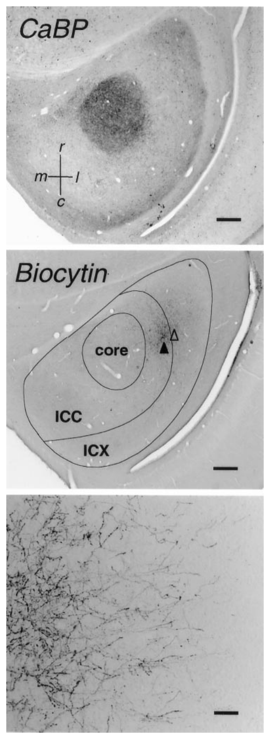
Tracer anatomy identifies the ICC-to-ICX projection
Anterograde tracing labels projections from cell bodies toward their axon terminals. DeBello and colleagues injected biocytin into timing-defined ICC sites and reconstructed the labeled axons that extended into ICX. Tracer injection followed the timing-defined ICC sites that the recordings identified. The injection sites were defined by their timing preference, which connects the anatomy to the recordings.
A calcium-binding-protein stain identified the ICC core as an anatomical reference. Biocytin labeling revealed the projection field and individual bouton-bearing axons. The published sections include 500 µm scale bars for overall organization and 100 µm bars for the higher-magnification projection image. The published sections give the scale of both the overall organization and the labeled boutons.
Tracing measures how axons are physically distributed rather than how they fire. It can distinguish a change in projection geometry from a change in physiological weighting. Synaptic strength, transmitter release, and activity during a sound fall outside what the label reports. Tracing is therefore the right method for measuring the spatial arrangement of projections.
DeBello et al. (2001), Fig. 2. Histological tracing of central-to-external collicular axons.
DeBello et al. (2001)
34
Notes:
Teaching transcript:
Anterograde tracing labels projections from neuronal cell bodies toward their axon terminals. DeBello and colleagues injected biocytin into timing-defined ICC sites and reconstructed the labeled axons extending into ICX.
A calcium-binding-protein stain identified the ICC core as an anatomical reference. Biocytin labeling revealed the projection field and individual bouton-bearing axons. The published sections include scale bars of 500 µm for anatomical organization and 100 µm for the higher-magnification projection image.
This approach measures the physical distribution of axons rather than their momentary firing. It can distinguish a change in projection geometry from a change in physiological weighting alone. The label does not directly measure synaptic strength, transmitter release, or the behavior of the traced axon during a sound.
A bouton is a localized swelling along or at the end of an axon, commonly associated with a presynaptic release site. Its appearance is anatomical evidence, not a measurement of release efficacy.
References:
William M. DeBello; Daniel E. Feldman; Eric I. Knudsen (2001). Adaptive Axonal Remodeling in the Midbrain Auditory Space Map. The Journal of Neuroscience 21(9):3161-3174. https://doi.org/10.1523/jneurosci.21-09-03161.2001
DeBello et al. (2001), Fig. 2. Histological tracing of central-to-external collicular axons.
Figure source: https://doi.org/10.1523/jneurosci.21-09-03161.2001

Slide 46
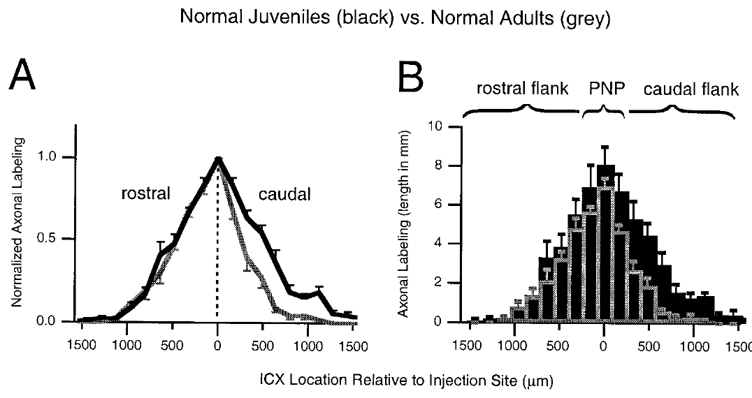
Normal development refines the projection field
DeBello and colleagues compared ICC-to-ICX projections in normal juvenile and adult owls, using equivalent tracing procedures. A projection field is the spatial region that contains axons from the labeled source population. Traced axons in juveniles and adults were compared using the same procedure. Equivalent procedures were used in juveniles and adults, so the anatomy can be compared directly.
Adult fields were narrower and sparser than juvenile fields. The reduction was strongest on the caudal flank, where total axonal labeling was about 68% lower in adults. Caudal means toward the rear, and rostral means toward the front; the peak region and rostral flank changed less. The caudal flank of the projection shows the largest reduction with age.
The pattern supports selective developmental refinement rather than uniform scaling of the whole projection. Different animals supplied each age group, so the study measures net anatomical differences rather than watching individual axons retract. Refinement of this kind sharpens the projection, and the peak region changed less. The projection geometry changes with development, while its core remains the reference.
DeBello et al. (2001), Fig. 6(A–B). Juvenile and adult distributions of traced axons.
Feldman & Knudsen (1998), Fig. 2(A). ICCls, ICX, and optic-tectum locations.
DeBello et al. (2001)
35
Notes:
Teaching transcript:
DeBello and colleagues compared ICC-to-ICX projections in normal juvenile and adult owls using equivalent tracing procedures. A projection field is the spatial region containing axons from the labeled source population.
Adult fields were narrower and sparser than juvenile fields. The reduction was strongest on the caudal flank, where total axonal labeling was about 68% lower in adults. Caudal means toward the rear; rostral means toward the front. The peak region and rostral flank changed less.
The pattern supports selective developmental refinement rather than uniform scaling of the entire projection. Because different animals supplied the age groups, the study measures net anatomical differences rather than observing individual axons retract. The result provides the normal developmental reference for evaluating prism-dependent remodeling.
Spatially selective loss can sharpen a projection without moving every surviving axon. The cross-sectional comparison does not distinguish each individual elimination event.
References:
William M. DeBello; Daniel E. Feldman; Eric I. Knudsen (2001). Adaptive Axonal Remodeling in the Midbrain Auditory Space Map. The Journal of Neuroscience 21(9):3161-3174. https://doi.org/10.1523/jneurosci.21-09-03161.2001
Daniel E. Feldman; Eric I. Knudsen (1998). Pharmacological Specialization of Learned Auditory Responses in the Inferior Colliculus of the Barn Owl. The Journal of Neuroscience 18(8):3073-3087. https://doi.org/10.1523/jneurosci.18-08-03073.1998
DeBello et al. (2001), Fig. 6(A–B). Juvenile and adult distributions of traced axons.
Figure source: https://doi.org/10.1523/jneurosci.21-09-03161.2001
Feldman & Knudsen (1998), Fig. 2(A). ICCls, ICX, and optic-tectum locations.
Figure source: https://doi.org/10.1523/jneurosci.18-08-03073.1998

Slide 47
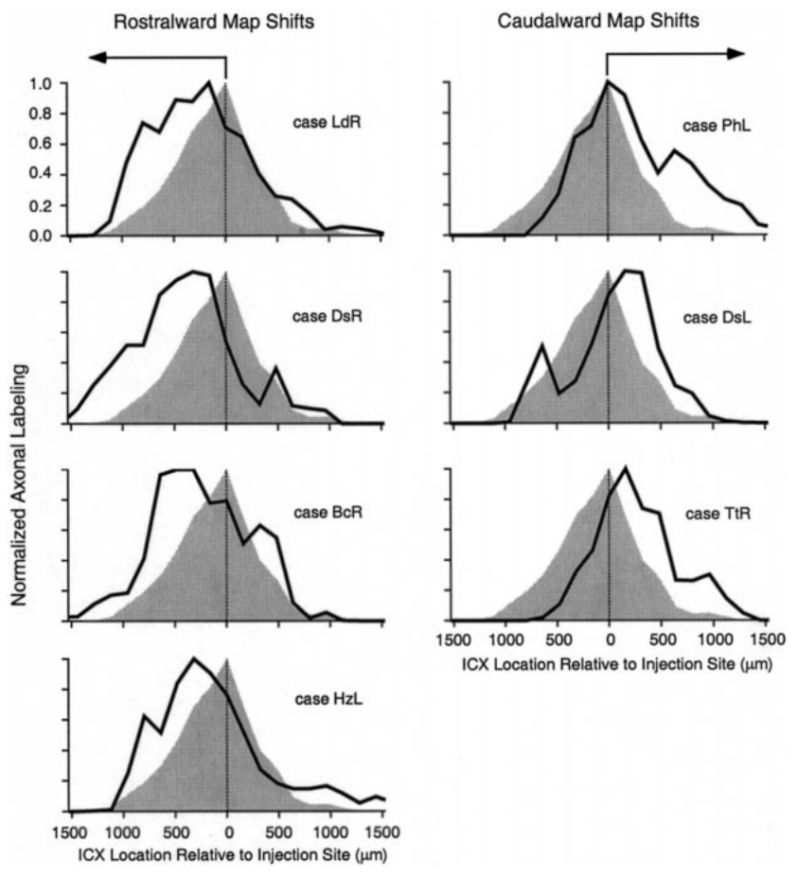
Prism experience changes where projections extend
DeBello and colleagues compared labeled ICC-to-ICX projections in prism-reared owls with the normal adult pattern. Injection sites represented similar timing values, so differences in target distribution can be linked to the direction of the adaptive shift. Rostralward and caudalward physiological shifts were examined separately. Each direction was examined on its own.
Projections associated with rostralward physiological shifts extended more strongly toward the rostral side of ICX. Caudalward shifts were associated with a different pattern of extension and preservation. The roughly 23° optical manipulation corresponded to spatially appropriate anatomical changes rather than indiscriminate expansion. The anatomical changes were spatially matched to the shift direction.
The tracing supports remodeling of the auditory input pathway. Each added branch's share of a measured learned spike response is a separate measurement, and the anatomical and physiological correspondence constrains the mechanism without assigning a share to each connection. Anatomy and physiology correspond in direction across the adaptive shift in these owls.
DeBello et al. (2001), Fig. 9. Projection distributions in prism-adapted owls.
DeBello et al. (2001)
36
Notes:
Teaching transcript:
DeBello and colleagues compared labeled ICC-to-ICX projections in prism-reared owls with the normal adult pattern. Injection sites represented similar timing values, so differences in target distribution could be related to the direction of the adaptive map shift.
Projections associated with rostralward physiological shifts extended more strongly toward the rostral side of ICX. Caudalward shifts were associated with a different pattern of extension and preservation. The approximately 23° optical manipulation therefore corresponded to spatially appropriate anatomical changes rather than indiscriminate expansion.
The tracing supports remodeling of the auditory input pathway. It does not establish that every additional labeled branch is responsible for a measured learned spike response. The anatomical and physiological correspondence constrains the mechanism without identifying the contribution of each individual connection.
The direction of map adjustment differs between the two sides of the brain. Anatomical comparisons must therefore distinguish rostralward and caudalward shifts rather than pooling them.
References:
William M. DeBello; Daniel E. Feldman; Eric I. Knudsen (2001). Adaptive Axonal Remodeling in the Midbrain Auditory Space Map. The Journal of Neuroscience 21(9):3161-3174. https://doi.org/10.1523/jneurosci.21-09-03161.2001
DeBello et al. (2001), Fig. 9. Projection distributions in prism-adapted owls.
Figure source: https://doi.org/10.1523/jneurosci.21-09-03161.2001

Slide 48
Light microscopy shows presence, not strength
A bouton is a localized swelling along or at the end of an axon, commonly associated with a presynaptic release site. Its appearance is anatomical evidence rather than a measure of release efficacy. The swelling is a candidate site for transmitter release. Light microscopy identifies boutons by their shape along labeled axons.
Spatially selective loss can sharpen a projection without moving every surviving axon. A cross-sectional comparison counts surviving axons at one moment rather than tracking each elimination event. Individual elimination events are not visible in a cross-sectional count. The count gives the net anatomical difference at each age.
Anatomical comparisons need to distinguish rostralward and caudalward shifts instead of pooling them. Pooled data would hide the direction of the change. The direction of each shift determines which side of the projection gains labeling. Two directions of shift need two distinct comparisons. The regional pattern is the quantity these measures summarize.
DeBello et al. (2001), Fig. 9. Projection distributions in prism-adapted owls.
DeBello et al. (2001)
36a
Notes:
Light microscopy shows presence, not strength.
Explanation 1.
A bouton is a localized swelling along or at the end of an axon, commonly associated with a presynaptic release site
Its appearance is anatomical evidence rather than a measure of release efficacy. The swelling is a candidate site for transmitter release. Light microscopy identifies boutons by their shape along labeled axons.
Explanation 2.
Spatially selective loss can sharpen a projection without moving every surviving axon
A cross-sectional comparison counts surviving axons at one moment rather than tracking each elimination event. Individual elimination events are not visible in a cross-sectional count. The count gives the net anatomical difference at each age.
Explanation 3.
Anatomical comparisons need to distinguish rostralward and caudalward shifts instead of pooling them
Pooled data would hide the direction of the change. The direction of each shift determines which side of the projection gains labeling. Two directions of shift need two distinct comparisons. The regional pattern is the quantity these measures summarize.
Source.
The figure and its data come from DeBello et al. (2001).
The full references are listed below.
References:
William M. DeBello; Daniel E. Feldman; Eric I. Knudsen (2001). Adaptive Axonal Remodeling in the Midbrain Auditory Space Map. The Journal of Neuroscience 21(9):3161-3174. https://doi.org/10.1523/jneurosci.21-09-03161.2001

Slide 49
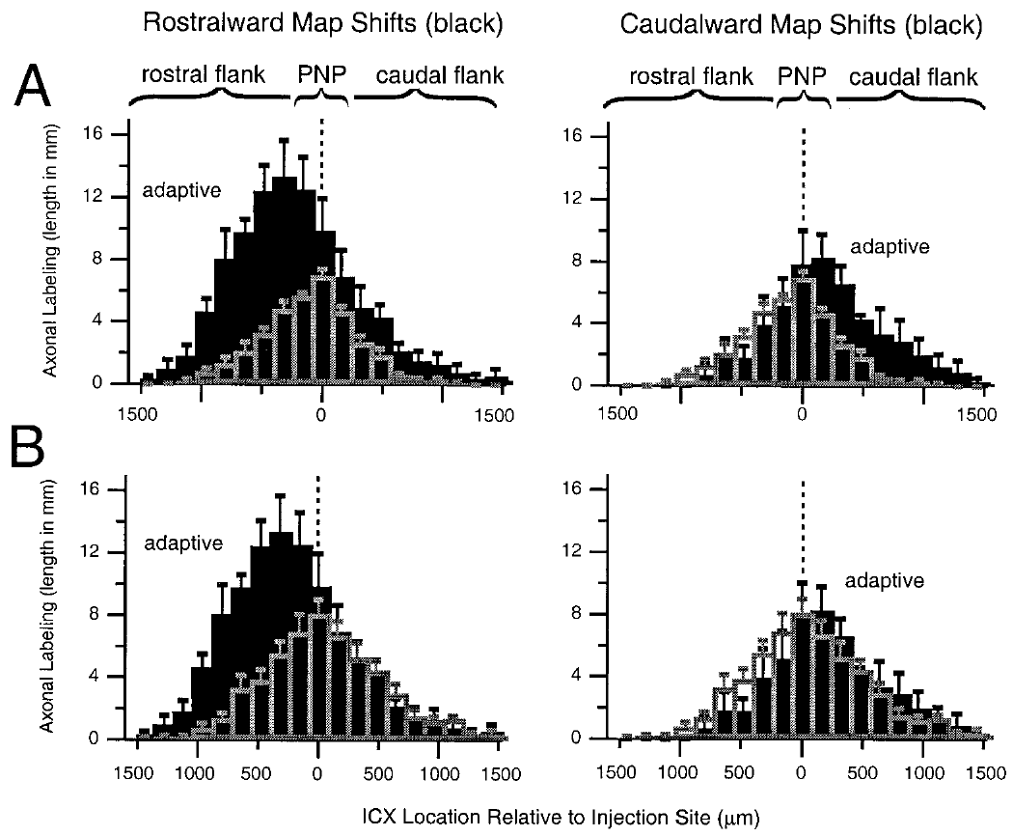
Adaptive expansion exceeds normal juvenile labeling
A broad projection in a prism-reared adult could reflect retained juvenile axons or growth beyond the juvenile pattern. DeBello and colleagues compared regional labeling with both normal juvenile and normal adult projections. Juvenile and adult projections serve as two reference patterns for the adaptive projection. A projection can be broad for more than one reason, so the regional amounts are compared.
For rostralward shifts, the adaptive flank contained about 2.3 times the axonal density and bouton number measured on the corresponding juvenile flank. That exceeds simple preservation of the normal juvenile distribution. The subregions were defined relative to the normal peak. Subregions were chosen relative to the peak of the normal projection, which keeps the reference fixed.
The result supports net elaboration in the adaptive region. Several microscopic processes could increase labeled length, and the anatomy alone leaves that contribution open. Net elaboration means the adaptive region holds more labeled axon than the normal juvenile pattern supplies. The adaptive flank holds more labeled axon than the normal juvenile pattern.
DeBello et al. (2001), Fig. 10(A–B). Prism-reared projection fields compared with age controls.
Feldman & Knudsen (1998), Fig. 2(A). ICCls, ICX, and optic-tectum locations.
DeBello et al. (2001)
37
Notes:
Teaching transcript:
A broad projection in a prism-reared adult could reflect retained juvenile axons or growth beyond the juvenile pattern. DeBello and colleagues compared the regional amounts of labeled axon with both normal juvenile and normal adult projections.
For rostralward shifts, the adaptive flank contained about 2.3 times the axonal density and bouton number measured on the corresponding juvenile flank. This exceeded simple preservation of the normal juvenile distribution. The comparisons used projection subregions defined relative to the normal peak.
The result supports net elaboration in the adaptive region. It does not directly distinguish branch formation from all other microscopic contributions to increased labeled length, nor does it measure the strength of the resulting synapses. The regional increase is the established anatomical finding.
Preservation predicts an adult retaining approximately the earlier anatomical amount. An increase beyond the juvenile reference requires an additional net contribution to the projection.
References:
William M. DeBello; Daniel E. Feldman; Eric I. Knudsen (2001). Adaptive Axonal Remodeling in the Midbrain Auditory Space Map. The Journal of Neuroscience 21(9):3161-3174. https://doi.org/10.1523/jneurosci.21-09-03161.2001
Daniel E. Feldman; Eric I. Knudsen (1998). Pharmacological Specialization of Learned Auditory Responses in the Inferior Colliculus of the Barn Owl. The Journal of Neuroscience 18(8):3073-3087. https://doi.org/10.1523/jneurosci.18-08-03073.1998
DeBello et al. (2001), Fig. 10(A–B). Prism-reared projection fields compared with age controls.
Figure source: https://doi.org/10.1523/jneurosci.21-09-03161.2001
Feldman & Knudsen (1998), Fig. 2(A). ICCls, ICX, and optic-tectum locations.
Figure source: https://doi.org/10.1523/jneurosci.18-08-03073.1998

Slide 50
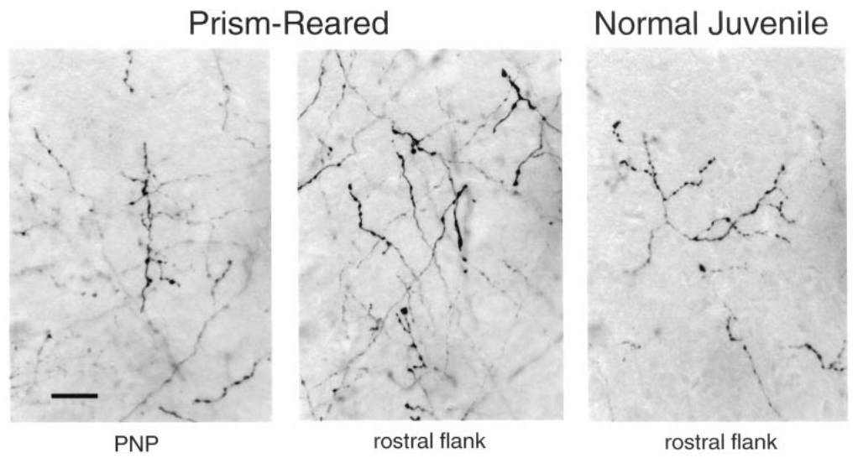
Adaptive axons carry presynaptic boutons
An additional axon branch matters more for circuit function when it carries potential synaptic contacts. DeBello and colleagues examined labeled axons in the adaptive flank and at the peak of the normal ICC-to-ICX projection. Boutons are the swellings that mark potential presynaptic sites along labeled axons. Labeled axons in these sections were measured at both locations.
The prism-associated axons were branched and carried boutons. Bouton-bearing axons appeared in the newly expanded region as well as in the normal projection region, which links the altered geometry with potential presynaptic input. The original micrographs retained a 20 µm scale bar. The prism-associated axons carried boutons in both the adaptive and the normal region.
Light microscopy shows a bouton's presence, but it reveals neither its receptor partners nor its functional efficacy. Synapse formation is therefore inferred from anatomical characterization of labeled boutons, and light microscopy places the bouton at a site. Such inference relies on the anatomical characterization and on earlier evidence about labeled boutons. Direct recordings of each contact were not made.
DeBello et al. (2001), Fig. 11. Bouton-bearing axons in normal and prism-reared ICX.
DeBello et al. (2001)
38
Notes:
Teaching transcript:
An additional axon branch is more relevant to circuit function when it contains potential synaptic contacts. DeBello and colleagues examined the labeled axons in the adaptive flank and at the peak of the normal ICC-to-ICX projection.
The prism-associated axons were branched and carried boutons. The original micrographs retain a 20 µm scale bar. Bouton-bearing axons were present in the newly expanded region as well as in the normal projection region, linking altered projection geometry with potential presynaptic input.
The anatomy supports an adaptive circuit containing opportunities for synaptic transmission. A bouton visible by light microscopy does not reveal its receptor partners or its functional efficacy. The inference of synaptogenesis relies on the anatomical characterization and prior evidence about labeled boutons, rather than a direct recording from each contact.
A presynaptic structure belongs to the transmitting side of a synapse. The receiving dendrite and its receptor currents require additional methods to characterize.
References:
William M. DeBello; Daniel E. Feldman; Eric I. Knudsen (2001). Adaptive Axonal Remodeling in the Midbrain Auditory Space Map. The Journal of Neuroscience 21(9):3161-3174. https://doi.org/10.1523/jneurosci.21-09-03161.2001
DeBello et al. (2001), Fig. 11. Bouton-bearing axons in normal and prism-reared ICX.
Figure source: https://doi.org/10.1523/jneurosci.21-09-03161.2001

Slide 51
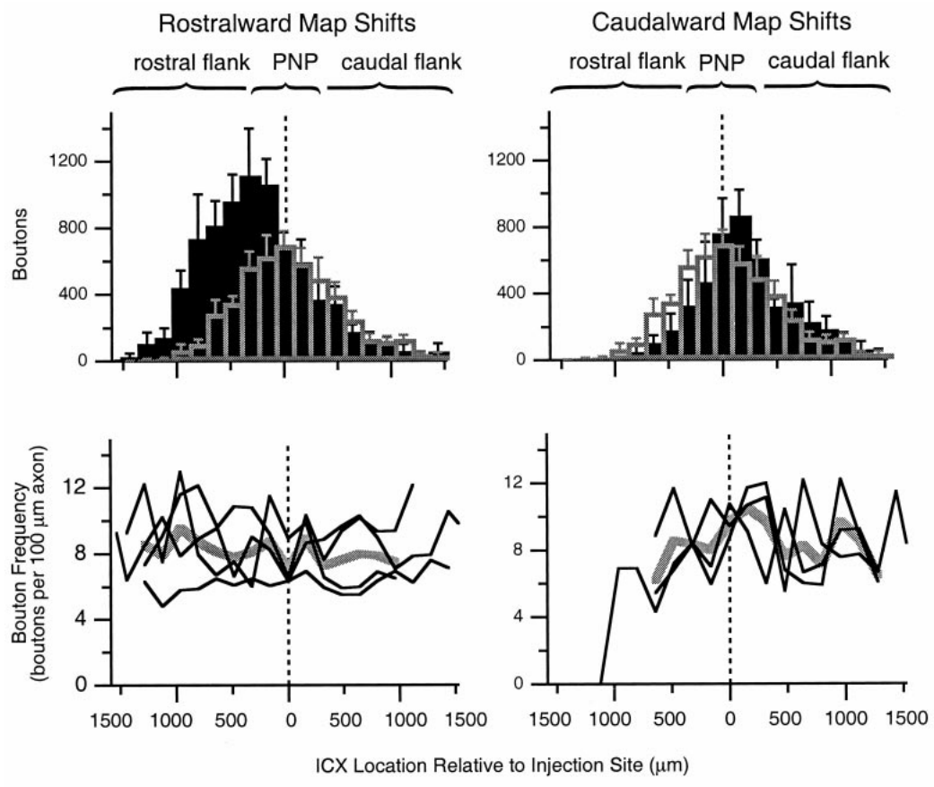
Bouton distributions follow adaptive projection changes
A circuit can change its number of potential contacts by changing axon length, bouton frequency along axons, or both. DeBello and colleagues quantified bouton distributions together with the spatial distribution of traced projection axons. Each route predicts a different pattern of bouton labeling. Both routes can operate in the same projection.
Prism-reared cases contained more bouton labeling in the adaptive portions of the projection. The analysis compared rostralward and caudalward shifts with the normal juvenile pattern and measured bouton frequency along axonal segments. The regional increase tracked the projection remodeling rather than a uniform addition across ICX. Both age groups were measured with equivalent tracing procedures.
These measures describe structural opportunities for auditory input. Glutamate release per bouton and postsynaptic current per contact lie beyond their reach, and a larger projection can coexist with physiological suppression when inhibition or efficacy limits it. A projection with more boutons may still express less current. The two quantities answer separate questions.
DeBello et al. (2001), Fig. 12. Regional bouton distributions and bouton frequency.
Feldman & Knudsen (1998), Fig. 2(A). ICCls, ICX, and optic-tectum locations.
DeBello et al. (2001)
39
Notes:
Teaching transcript:
A circuit can change its number of potential contacts by changing axon length, bouton frequency along axons, or both. DeBello and colleagues quantified bouton distributions together with the spatial distribution of traced projection axons.
Prism-reared cases contained increased bouton labeling in the adaptive portions of the projection. The analysis compared rostralward and caudalward shifts with the normal juvenile pattern and examined frequency along measured axonal segments. The regional increase corresponded to the projection remodeling rather than a uniform addition throughout ICX.
These measures describe structural opportunities for auditory input. They do not establish the amount of glutamate released per bouton or the postsynaptic current per contact. A larger anatomical projection can coexist with physiological suppression when inhibitory input or synaptic efficacy limits its expression.
Bouton frequency is the number of boutons per measured axonal length. It differs from the total number of boutons contributed by an entire projection field.
References:
William M. DeBello; Daniel E. Feldman; Eric I. Knudsen (2001). Adaptive Axonal Remodeling in the Midbrain Auditory Space Map. The Journal of Neuroscience 21(9):3161-3174. https://doi.org/10.1523/jneurosci.21-09-03161.2001
Daniel E. Feldman; Eric I. Knudsen (1998). Pharmacological Specialization of Learned Auditory Responses in the Inferior Colliculus of the Barn Owl. The Journal of Neuroscience 18(8):3073-3087. https://doi.org/10.1523/jneurosci.18-08-03073.1998
DeBello et al. (2001), Fig. 12. Regional bouton distributions and bouton frequency.
Figure source: https://doi.org/10.1523/jneurosci.21-09-03161.2001
Feldman & Knudsen (1998), Fig. 2(A). ICCls, ICX, and optic-tectum locations.
Figure source: https://doi.org/10.1523/jneurosci.18-08-03073.1998

Slide 52
Bouton frequency differs from total boutons
Bouton frequency is the number of boutons per measured axonal length. It differs from the total number of boutons contributed by an entire projection field. A projection can gain contacts through longer axons or denser boutons. The two routes give different patterns of bouton labeling.
Preservation predicts an adult retaining approximately the earlier anatomical amount. An increase beyond the juvenile reference requires an additional net contribution to the projection. The adaptive projection is measured against both references. Preservation and elaboration give different predictions for the same measurement.
A presynaptic structure belongs to the transmitting side of a synapse. The receiving dendrite and its receptor currents require additional methods to characterize. Presynaptic labeling alone shows one side of the contact. The postsynaptic side of each contact is measured separately.
DeBello et al. (2001), Fig. 12. Regional bouton distributions and bouton frequency.
Feldman & Knudsen (1998), Fig. 2(A). ICCls, ICX, and optic-tectum locations.
DeBello et al. (2001)
39a
Notes:
Bouton frequency differs from total boutons.
Explanation 1.
Bouton frequency is the number of boutons per measured axonal length
It differs from the total number of boutons contributed by an entire projection field. A projection can gain contacts through longer axons or denser boutons. The two routes give different patterns of bouton labeling.
Explanation 2.
Preservation predicts an adult retaining approximately the earlier anatomical amount
An increase beyond the juvenile reference requires an additional net contribution to the projection. The adaptive projection is measured against both references. Preservation and elaboration give different predictions for the same measurement.
Explanation 3.
A presynaptic structure belongs to the transmitting side of a synapse
The receiving dendrite and its receptor currents require additional methods to characterize. Presynaptic labeling alone shows one side of the contact. The postsynaptic side of each contact is measured separately.
Source.
The figure and its data come from DeBello et al. (2001).
The full references are listed below.
References:
William M. DeBello; Daniel E. Feldman; Eric I. Knudsen (2001). Adaptive Axonal Remodeling in the Midbrain Auditory Space Map. The Journal of Neuroscience 21(9):3161-3174. https://doi.org/10.1523/jneurosci.21-09-03161.2001

Slide 53
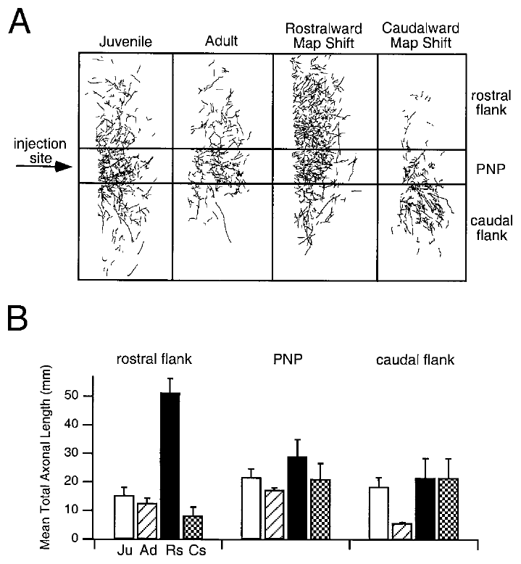
The normal projection survives alongside adaptive inputs
Prism adaptation leaves the original auditory pathway in place. DeBello and colleagues found that axonal and bouton labeling around the peak of the normal projection stayed comparable to, or greater than, levels in normal controls. Labeling around the normal peak remained high in the prism-reared owls. This anatomical result is central to the recovery argument.
Prism-reared owls therefore retained the anatomical substrate for normal timing inputs while also possessing appropriately placed adaptive projections. The spatial comparisons used the same normal-peak reference and distinguished rostralward from caudalward shifts. The retained normal projection sat at the normal peak, while the adaptive projection sat in the shifted region.
Coexisting projections offer a plausible substrate for recovery after prism removal. Synaptic strengths and inhibitory gating lie beyond what the tracer measures, so anatomical persistence and physiological expression are distinct properties of a circuit. Tracer labeling reports structure, while the spike response reports function. Tracer labeling reports structure, while the spike response reports function.
DeBello et al. (2001), Fig. 15(A–B). Normal projection regions retained in prism-reared owls.
DeBello et al. (2001)
40
Notes:
Teaching transcript:
Prism adaptation does not require complete removal of the original auditory pathway. DeBello and colleagues found that axonal and bouton labeling around the peak of the normal projection remained comparable to, or greater than, that in normal control groups.
Prism-reared owls therefore retained the anatomical substrate for normal timing inputs while also possessing appropriately placed adaptive projections. The spatial comparisons used the same normal-peak reference and separated rostralward from caudalward map shifts.
Coexistence of these projections provides a plausible substrate for recovery after prism removal. It is not proof that the retained contacts alone explain recovery, because their synaptic strengths and inhibitory gating were not measured by the tracer. Anatomical persistence and physiological expression are distinct properties of a circuit.
A pathway can persist anatomically while contributing little to the measured spike response. Re-expression can require changes in functional weighting even when no new axon is necessary.
References:
William M. DeBello; Daniel E. Feldman; Eric I. Knudsen (2001). Adaptive Axonal Remodeling in the Midbrain Auditory Space Map. The Journal of Neuroscience 21(9):3161-3174. https://doi.org/10.1523/jneurosci.21-09-03161.2001
DeBello et al. (2001), Fig. 15(A–B). Normal projection regions retained in prism-reared owls.
Figure source: https://doi.org/10.1523/jneurosci.21-09-03161.2001

Slide 54
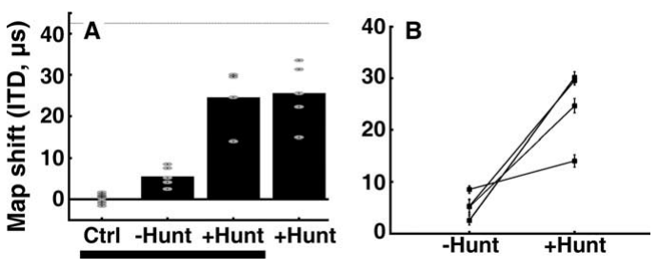
Adult hunting increases expressed map plasticity
Bergan and colleagues tested whether an ecologically important behavior could increase adult auditory plasticity. Adult owls wore 17° prisms while receiving dead mice or hunting live mice during one-hour daily feeding sessions in communal aviaries. The hunting condition added a behavior that required the owls to capture moving prey. The two feeding conditions differed in whether the owls captured the mice.
After 10 weeks without hunting, the median map shift was about 5 µs. With hunting, it was about 25 µs, roughly five times larger. A separate group introduced directly to hunting showed a similar median shift of 26 µs after eight weeks. The hunting group's shift grew over the same period as the no-hunting group's.
Hunting increased adult adaptation without restoring the full juvenile response. The experiment changed several features of experience together, so no single neuromodulator was identified as the causal signal. Experience of the whole feeding situation was tested, not any single transmitter. The hunting condition combined movement, sound, and a consequence for strikes. Hunting, in this sense, was the manipulation.
Bergan et al. (2005), Fig. 2(A–B). Adult timing-map shifts with and without hunting.
Feldman & Knudsen (1998), Fig. 2(A). ICCls, ICX, and optic-tectum locations.
Bergan et al. (2005)
41
Notes:
Teaching transcript:
Bergan and colleagues tested whether an ecologically important behavior could increase adult auditory plasticity. Adult owls experienced 17° prisms while either receiving dead mice or hunting live mice during one-hour daily feeding sessions in communal aviaries.
After 10 weeks without hunting, the median map shift was about 5 µs. With hunting, it was about 25 µs, approximately five times larger. A separate group introduced directly to hunting showed a similar 26 µs median shift after eight weeks, reducing concern that previous prism exposure alone explained the effect.
Hunting increased adult adaptation but did not restore the full juvenile response. The experiment changed several features of experience together and did not isolate a particular neuromodulator as the causal signal.
The predicted full shift for the 17-degree displacement was approximately 42.5 microseconds. The adult hunting response was substantial but remained incomplete.
References:
Joseph F. Bergan; Peter Ro; Daniel Ro; Eric I. Knudsen (2005). Hunting Increases Adaptive Auditory Map Plasticity in Adult Barn Owls. The Journal of Neuroscience 25(42):9816-9820. https://doi.org/10.1523/jneurosci.2533-05.2005
Daniel E. Feldman; Eric I. Knudsen (1998). Pharmacological Specialization of Learned Auditory Responses in the Inferior Colliculus of the Barn Owl. The Journal of Neuroscience 18(8):3073-3087. https://doi.org/10.1523/jneurosci.18-08-03073.1998
Bergan et al. (2005), Fig. 2(A–B). Adult timing-map shifts with and without hunting.
Figure source: https://doi.org/10.1523/jneurosci.2533-05.2005
Feldman & Knudsen (1998), Fig. 2(A). ICCls, ICX, and optic-tectum locations.
Figure source: https://doi.org/10.1523/jneurosci.18-08-03073.1998

Slide 55
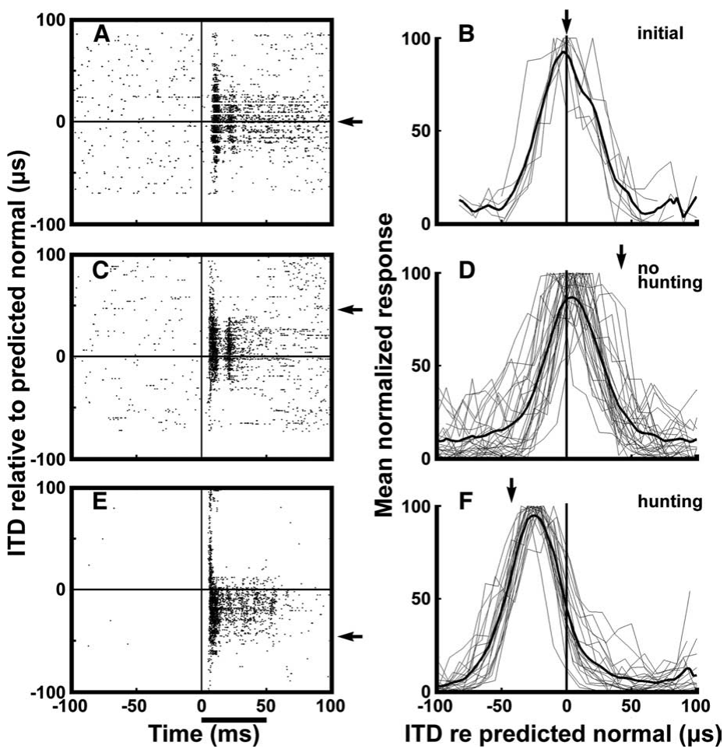
Hunting produces more consistent timing-map shifts
Bergan and colleagues recorded tectal responses to 50 ms broadband noise bursts delivered separately to the two ears. The 2–10 kHz stimuli were presented 20–30 dB above auditory threshold, and visual receptive fields established the normal timing reference. Stimulus level was set relative to each animal's own auditory threshold for these stimuli.
In a representative adult, 10 weeks of prism experience without hunting produced a small shift. After normal calibration was restored and an opposite displacement was paired with hunting, responses shifted substantially farther, and individual sites agreed more consistently with the adaptive mapping. Responses to the paired displacement were recorded at the same tectal sites.
Raster displays and population tuning connect the behavioral condition with the organization of neuronal responses. The recording measures sensory tuning under controlled stimulation, so the signals present during each prey strike remain outside the data. Each recording site contributes one timing preference to the population display. Those signals fall outside these measurements.
Bergan et al. (2005), Fig. 1(A–F). Adult neural responses before and after hunting experience.
Feldman & Knudsen (1998), Fig. 2(A). ICCls, ICX, and optic-tectum locations.
Bergan et al. (2005)
42
Notes:
Teaching transcript:
Bergan and colleagues recorded tectal responses to 50 ms broadband noise bursts delivered independently to the two ears. The 2–10 kHz stimuli were presented 20–30 dB above auditory threshold, while visual receptive fields established the normal timing reference.
In a representative adult, 10 weeks of prism experience without hunting produced a small shift. After normal calibration was restored and an opposite displacement was paired with hunting, responses shifted substantially farther and individual sites agreed more consistently with the adaptive mapping.
The raster displays and population tuning therefore connect the behavioral condition with neuronal response organization. The recording measures sensory tuning under controlled stimulation; it does not directly observe the signals that occurred during each prey strike or identify the teaching event within a hunting session.
A raster display marks individual spike times across repeated stimulus presentations. Population tuning combines the timing preferences of multiple recording sites.
References:
Joseph F. Bergan; Peter Ro; Daniel Ro; Eric I. Knudsen (2005). Hunting Increases Adaptive Auditory Map Plasticity in Adult Barn Owls. The Journal of Neuroscience 25(42):9816-9820. https://doi.org/10.1523/jneurosci.2533-05.2005
Daniel E. Feldman; Eric I. Knudsen (1998). Pharmacological Specialization of Learned Auditory Responses in the Inferior Colliculus of the Barn Owl. The Journal of Neuroscience 18(8):3073-3087. https://doi.org/10.1523/jneurosci.18-08-03073.1998
Bergan et al. (2005), Fig. 1(A–F). Adult neural responses before and after hunting experience.
Figure source: https://doi.org/10.1523/jneurosci.2533-05.2005
Feldman & Knudsen (1998), Fig. 2(A). ICCls, ICX, and optic-tectum locations.
Figure source: https://doi.org/10.1523/jneurosci.18-08-03073.1998

Slide 56
Raster displays show response organization
A raster display marks individual spike times across repeated stimulus presentations, with each row representing one presentation. Population tuning combines the timing preferences of multiple recording sites. The display shows variability across trials as well as the typical timing.
The predicted full shift for the 17-degree displacement was approximately 42.5 microseconds. The adult hunting response was substantial but remained incomplete. The predicted value is the benchmark against which the hunting shifts are judged. The predicted value is a reference, not a measured endpoint.
Correlation between map change and strike performance constrains the functional interpretation, though a selective causal manipulation would still be needed. The strike performance is a behavioral outcome, not a neural measure. Its link to the map is a correlation across sessions.
Bergan et al. (2005), Fig. 1(A–F). Adult neural responses before and after hunting experience.
Feldman & Knudsen (1998), Fig. 2(A). ICCls, ICX, and optic-tectum locations.
Bergan et al. (2005)
42a
Notes:
Raster displays show response organization.
Explanation 1.
A raster display marks individual spike times across repeated stimulus presentations, with each row representing one presentation
Population tuning combines the timing preferences of multiple recording sites. The display shows variability across trials as well as the typical timing.
Explanation 2.
The predicted full shift for the 17-degree displacement was approximately 42.5 microseconds
The adult hunting response was substantial but remained incomplete. The predicted value is the benchmark against which the hunting shifts are judged. The predicted value is a reference, not a measured endpoint.
Explanation 3.
Correlation between map change and strike performance constrains the functional interpretation, though a selective causal manipulation would still be needed
The strike performance is a behavioral outcome, not a neural measure. Its link to the map is a correlation across sessions.
Source.
The figure and its data come from Bergan et al. (2005).
The full references are listed below.
References:
Joseph F. Bergan; Peter Ro; Daniel Ro; Eric I. Knudsen (2005). Hunting Increases Adaptive Auditory Map Plasticity in Adult Barn Owls. The Journal of Neuroscience 25(42):9816-9820. https://doi.org/10.1523/jneurosci.2533-05.2005

Slide 57
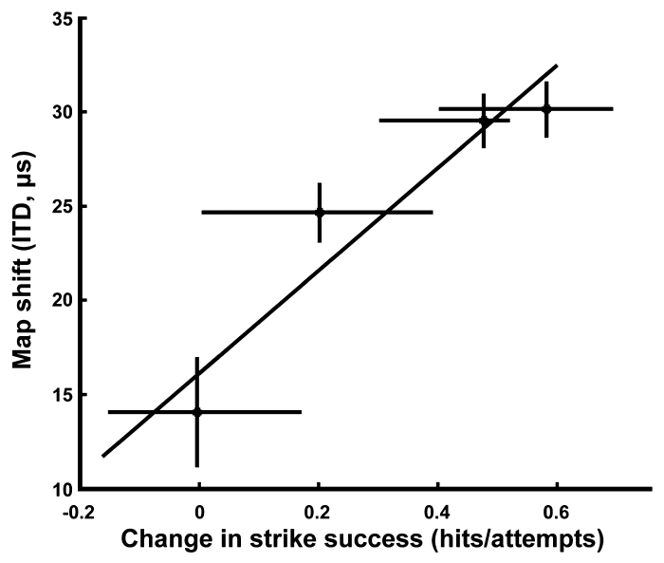
Improved prey capture accompanies auditory remapping
Strike success is the proportion of attempts in which the owl captures the target mouse. Bergan and colleagues measured this outcome while adult owls hunted with prismatic displacement, linking neural adjustment to a natural localization task. Strike success was measured as the owl's capture rate on each target mouse. Each owl contributed its own attempts.
Average success was about 89% without prisms and fell to about 27% immediately after prism attachment. During later hunting experience, improved capture covaried with the amount of adaptive timing-map shift. The prism condition challenged cross-modal localization during an action with a clear consequence. These values come from the same owls before and after prisms.
The association supports a functional role for auditory remapping. Movement strategies and other sensory processes could also change, so map adjustment is one contributor among several. Neural tuning and behavior are related outcomes rather than interchangeable measurements. Its change tracked the adaptive shift across hunting sessions. The association is a correlation, not a causal test.
Bergan et al. (2005), Fig. 3. Map adjustment versus improvement in strike success.
Bergan et al. (2005)
43
Notes:
Teaching transcript:
Strike success is the proportion of attempts in which the owl captures the target mouse. Bergan and colleagues measured this behavioral outcome while adult owls hunted with prismatic displacement, linking neural adjustment with a natural localization task.
Average success was about 89% without prisms and fell to about 27% immediately after prism attachment. During subsequent hunting experience, improved capture performance covaried with the amount of adaptive timing-map shift. The prism condition challenged cross-modal localization during an action with a clear behavioral consequence.
The association supports the functional relevance of auditory remapping. It does not establish that map adjustment was the only contributor to improved capture, because movement strategies and other sensory processes could also change. Neural tuning and behavior were related outcomes, not interchangeable measurements.
The study compared change in strike performance with change in the map. Correlation constrains the functional interpretation but does not replace a selective causal manipulation.
References:
Joseph F. Bergan; Peter Ro; Daniel Ro; Eric I. Knudsen (2005). Hunting Increases Adaptive Auditory Map Plasticity in Adult Barn Owls. The Journal of Neuroscience 25(42):9816-9820. https://doi.org/10.1523/jneurosci.2533-05.2005
Bergan et al. (2005), Fig. 3. Map adjustment versus improvement in strike success.
Figure source: https://doi.org/10.1523/jneurosci.2533-05.2005

Slide 58
Natural experience changes the conditions for learning
The hunting manipulation kept many aspects of the adult owls' environment unchanged while altering the task of obtaining food. Both groups had one-hour feeding periods, lived in aviaries, and oriented and flew toward mice. Hunting alone required capturing live prey. Feeding and aviary conditions were matched between the groups. Both groups saw mice at each feeding.
Live mice supplied movement and rustling sounds, combined visual and auditory information, and gave a consequence for inaccurate strikes. Adult map shifts increased from roughly 5 to 25 µs under the hunting condition. These differences suggest several routes by which natural behavior could enhance plasticity. The shifts measured in the two groups differed by about five times.
Attention, arousal, sensory information, and reward were proposed as contributors. No transmitter such as dopamine or acetylcholine was manipulated, and hunting is therefore the compound experience that increased adaptive plasticity in the adult map. The compound hunting experience is the defined manipulation in this study. Its effect was measured against the no-hunting group.
Bergan et al. (2005), Fig. 2(A–B). Adult adaptation depends on the feeding condition.
Feldman & Knudsen (1998), Fig. 2(A). ICCls, ICX, and optic-tectum locations.
Bergan et al. (2005)
44
Notes:
Teaching transcript:
The hunting manipulation preserved many aspects of the adult owls’ environment while changing the task of obtaining food. Both groups had one-hour feeding periods, lived in aviaries, and oriented and flew toward mice. Only the hunting condition required capturing live prey.
Live mice supplied movement and rustling sounds, coupled visual and auditory information, and a consequence for inaccurate strikes. Adult map shifts increased from roughly 5 to 25 µs under the hunting condition. These differences suggest several possible routes by which natural behavior could enhance plasticity.
Attention, arousal, sensory information, and reward were proposed contributors, not separately established mechanisms. The study did not manipulate dopamine, acetylcholine, or another transmitter. The defensible conclusion is that the compound hunting experience increased adaptive plasticity in the adult map.
A behavioral state manipulation can identify a condition that promotes learning without establishing a molecular pathway. Naming a candidate neuromodulator would require additional source evidence.
References:
Joseph F. Bergan; Peter Ro; Daniel Ro; Eric I. Knudsen (2005). Hunting Increases Adaptive Auditory Map Plasticity in Adult Barn Owls. The Journal of Neuroscience 25(42):9816-9820. https://doi.org/10.1523/jneurosci.2533-05.2005
Daniel E. Feldman; Eric I. Knudsen (1998). Pharmacological Specialization of Learned Auditory Responses in the Inferior Colliculus of the Barn Owl. The Journal of Neuroscience 18(8):3073-3087. https://doi.org/10.1523/jneurosci.18-08-03073.1998
Bergan et al. (2005), Fig. 2(A–B). Adult adaptation depends on the feeding condition.
Figure source: https://doi.org/10.1523/jneurosci.2533-05.2005
Feldman & Knudsen (1998), Fig. 2(A). ICCls, ICX, and optic-tectum locations.
Figure source: https://doi.org/10.1523/jneurosci.18-08-03073.1998

Slide 59
Map plasticity combines instruction and circuit change
Auditory-map adaptation involves distinct processes supported by different experiments. Regional visual manipulations identify the spatial information that guides change, recordings identify shifted timing preferences, receptor blockade identifies contributions to response expression, and tracing identifies altered projection anatomy. Each approach addresses a different part of the adaptation. The four methods are complementary.
Normal and adaptive projections can coexist after 23° prism experience. Recovery of normal tuning, differential NMDA dependence, and inhibitory suppression fit a circuit that holds several potential mappings and expresses them differently under different conditions. Each of these results fits that picture without contradiction. The same circuit accommodates each result.
No single experiment links visual error, axon growth, and successful localization in one chain. The supported account combines complementary evidence, and developmental age, prior calibration, environmental richness, and behavioral engagement all shape how much plasticity appears. The regional, drug, and tracing results each narrow the explanation. Each result constrains the account from a different side.
DeBello et al. (2001), Fig. 15(A–B). Coexisting normal and adaptive anatomical projections.
DeBello et al. (2001)
45
Notes:
Teaching transcript:
Auditory-map adaptation involves distinct processes supported by different experiments. Regional visual manipulations identify the spatial information guiding change; recordings identify shifted timing preferences; receptor blockade identifies contributions to response expression; tracing identifies altered projection anatomy.
The normal and adaptive projections can coexist after 23° prism experience. Recovery of normal tuning, differential NMDA dependence, and inhibitory suppression are therefore compatible with a circuit that retains several potential mappings but expresses them differently under different conditions.
No single experiment establishes the complete chain from visual error to axon growth to successful localization. The supported account combines complementary evidence while preserving those limits. Developmental age, prior calibration, environmental richness, and behavioral engagement all affect the amount or form of plasticity expressed.
The anatomical persistence measured by DeBello and colleagues supports an available substrate. Connecting that substrate to receptor changes and behavioral recovery remains a synthesis across studies.
References:
William M. DeBello; Daniel E. Feldman; Eric I. Knudsen (2001). Adaptive Axonal Remodeling in the Midbrain Auditory Space Map. The Journal of Neuroscience 21(9):3161-3174. https://doi.org/10.1523/jneurosci.21-09-03161.2001
DeBello et al. (2001), Fig. 15(A–B). Coexisting normal and adaptive anatomical projections.
Figure source: https://doi.org/10.1523/jneurosci.21-09-03161.2001

Slide 60
Key takeaways
Vision calibrates auditory space. Prismatic displacement alters the association between acoustic timing cues and represented location; regional visual information provides topographic instruction.
Sensitive periods depend on the task and environment. Learning an unfamiliar displacement and recovering normal tuning have different age constraints, and rich experience can permit recovery after failure in cages.
ICX expresses adaptive circuit change. Timing-specific central-collicular input is transformed into a shifted auditory-space representation, supported by experience-dependent projection remodeling.
Learned responses initially depend more on NMDA receptors. AP-5 preferentially reduces newly learned responses; that differential effect disappears after extended prism experience.
Inhibition controls which inputs are expressed. Early GABAergic inhibition can mask learned excitation, whereas later inhibition favors expression of the established adaptive mapping.
Adult learning retains behavioral relevance. Hunting increases adult map shifts and accompanies improved prey capture, while the normal anatomical projection persists alongside adaptive inputs.
Brainard & Knudsen (1993); Hyde & Knudsen (2001); Feldman & Knudsen (1998); Brainard & Knudsen (1998); Zheng & Knudsen (2001); DeBello et al. (2001); Bergan et al. (2005)
46
Notes:
Vision calibrates auditory space. Prismatic displacement alters the association between acoustic timing cues and represented location; regional visual information provides topographic instruction.
Sensitive periods depend on the task and environment. Learning an unfamiliar displacement and recovering normal tuning have different age constraints, and rich experience can permit recovery after failure in cages.
ICX expresses adaptive circuit change. Timing-specific central-collicular input is transformed into a shifted auditory-space representation, supported by experience-dependent projection remodeling.
Learned responses initially depend more on NMDA receptors. AP-5 preferentially reduces newly learned responses; that differential effect disappears after extended prism experience.
Inhibition controls which inputs are expressed. Early GABAergic inhibition can mask learned excitation, whereas later inhibition favors expression of the established adaptive mapping.
Adult learning retains behavioral relevance. Hunting increases adult map shifts and accompanies improved prey capture, while the normal anatomical projection persists alongside adaptive inputs.
References:
MS Brainard; EI Knudsen (1993). Experience-dependent plasticity in the inferior colliculus: a site for visual calibration of the neural representation of auditory space in the barn owl. The Journal of Neuroscience 13(11):4589-4608. https://doi.org/10.1523/jneurosci.13-11-04589.1993
Peter S. Hyde; Eric I. Knudsen (2001). A Topographic Instructive Signal Guides the Adjustment of the Auditory Space Map in the Optic Tectum. The Journal of Neuroscience 21(21):8586-8593. https://doi.org/10.1523/jneurosci.21-21-08586.2001
Daniel E. Feldman; Eric I. Knudsen (1998). Pharmacological Specialization of Learned Auditory Responses in the Inferior Colliculus of the Barn Owl. The Journal of Neuroscience 18(8):3073-3087. https://doi.org/10.1523/jneurosci.18-08-03073.1998
Michael S. Brainard; Eric I. Knudsen (1998). Sensitive Periods for Visual Calibration of the Auditory Space Map in the Barn Owl Optic Tectum. The Journal of Neuroscience 18(10):3929-3942. https://doi.org/10.1523/jneurosci.18-10-03929.1998
Weimin Zheng; Eric I. Knudsen (2001). GABAergic Inhibition Antagonizes Adaptive Adjustment of the Owl's Auditory Space Map during the Initial Phase of Plasticity. The Journal of Neuroscience 21(12):4356-4365. https://doi.org/10.1523/jneurosci.21-12-04356.2001
William M. DeBello; Daniel E. Feldman; Eric I. Knudsen (2001). Adaptive Axonal Remodeling in the Midbrain Auditory Space Map. The Journal of Neuroscience 21(9):3161-3174. https://doi.org/10.1523/jneurosci.21-09-03161.2001
Joseph F. Bergan; Peter Ro; Daniel Ro; Eric I. Knudsen (2005). Hunting Increases Adaptive Auditory Map Plasticity in Adult Barn Owls. The Journal of Neuroscience 25(42):9816-9820. https://doi.org/10.1523/jneurosci.2533-05.2005

