Slide 1
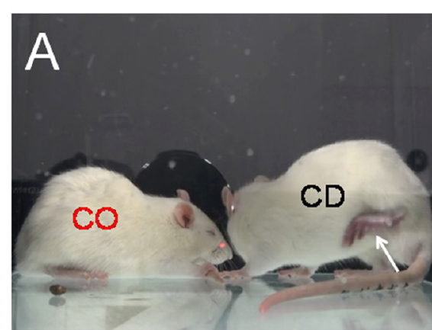
NEUR 411 · NEUROETHOLOGY · FALL 2026
Lecture 104B
Social transmission of pain in animals: sensory cues, neural circuits, and how social interactions alter pain sensitivity across species.
Date TBD
Jordan Lopez, Ph.D.
Professor of Neurobiology & Biomedical Engineering
Li et al. (2018), Fig. 2A. A familiar rat observer and demonstrator.
Notes:
Social transmission of pain in animals: sensory cues, neural circuits, and how social interactions alter pain sensitivity across species.
Lecture 104B. Date TBD.
Figure: Li et al. (2018), Fig. 2A. A familiar rat observer and demonstrator.
Figure source: https://doi.org/10.3389/fnbeh.2018.00242
References:
Li CL, Yu Y, He T, Wang RR, Geng KW, Du R, Luo WJ, Wei N, Wang XL, Wang Y, Yang Y, Yu YQ, Chen J. (2018). Validating Rat Model of Empathy for Pain: Effects of Pain Expressions in Social Partners. Frontiers in behavioral neuroscience 12:242. https://doi.org/10.3389/fnbeh.2018.00242

Slide 2
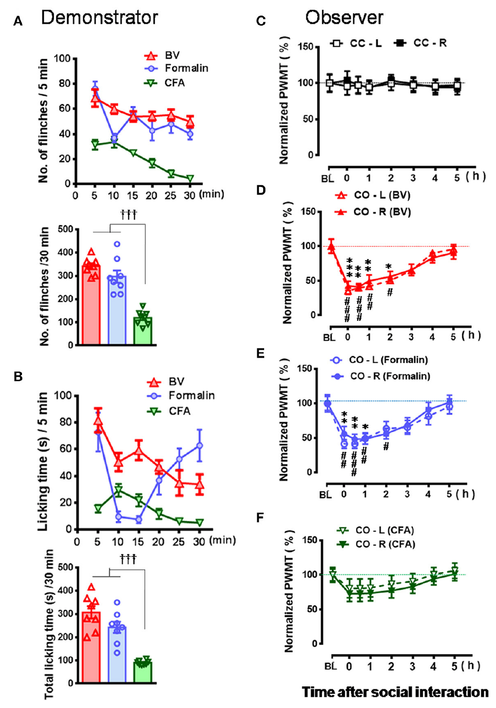
Social pain transfer changes an untreated animal’s response
Social transfer of pain sensitivity changes an untreated animal’s response after interaction with an affected partner. Li and colleagues tested this relationship in male rats. A demonstrator received a treatment producing a defined pain condition. An observer interacted with that familiar demonstrator without receiving the treatment. Subsequent stimulation measured the observer’s own sensitivity, rather than simply counting its reactions during observation.
The researchers measured the paw withdrawal mechanical threshold, the force eliciting withdrawal of a hind paw. Lower thresholds indicate greater responsiveness to mechanical stimulation. A von Frey filament bends at a calibrated force applied to the skin. Thresholds were measured before interaction and repeatedly afterward. Comparison with pain-free pairs separated the effect of social exposure from ordinary handling and repeated testing.
Different demonstrator treatments produced different visible behaviors and different observer outcomes. Bee venom and formalin elicited conspicuous paw licking and flinching. These conditions transferred mechanical hypersensitivity after 30 min of interaction. A less conspicuous inflammatory condition produced a weaker immediate effect. The relationship therefore depends on the available signals and the duration of exposure, rather than the observer sharing the demonstrator’s tissue injury.
Li et al. (2018), Fig. 2A. A familiar observer and demonstrator.
Li et al. (2018), Fig. 3A–F. Demonstrator expression and observer mechanical thresholds.
Li et al. (2018)
02
Notes:
• **Social transfer of pain sensitivity** changes an untreated animal’s response after interaction with an affected partner. Li and colleagues tested this relationship in male rats. A **demonstrator** received a treatment producing a defined pain condition. An **observer** interacted with that familiar demonstrator without receiving the treatment. Subsequent stimulation measured the observer’s own sensitivity, rather than simply counting its reactions during observation.
• The researchers measured the **paw withdrawal mechanical threshold**, the force eliciting withdrawal of a hind paw. Lower thresholds indicate greater responsiveness to mechanical stimulation. A **von Frey filament** bends at a calibrated force applied to the skin. Thresholds were measured before interaction and repeatedly afterward. Comparison with pain-free pairs separated the effect of social exposure from ordinary handling and repeated testing.
• Different demonstrator treatments produced different visible behaviors and different observer outcomes. Bee venom and formalin elicited conspicuous paw licking and flinching. These conditions transferred mechanical hypersensitivity after 30 min of interaction. A less conspicuous inflammatory condition produced a weaker immediate effect. The relationship therefore depends on the available signals and the duration of exposure, rather than the observer sharing the demonstrator’s tissue injury.
References:
Li CL, Yu Y, He T, Wang RR, Geng KW, Du R, Luo WJ, Wei N, Wang XL, Wang Y, Yang Y, Yu YQ, Chen J. (2018). Validating Rat Model of Empathy for Pain: Effects of Pain Expressions in Social Partners. Frontiers in behavioral neuroscience 12:242. https://doi.org/10.3389/fnbeh.2018.00242
Figure: Li et al. (2018), Fig. 3A–F. Demonstrator expression and observer mechanical thresholds.
Figure source: https://doi.org/10.3389/fnbeh.2018.00242
Figure: Li et al. (2018), Fig. 2A. A familiar observer and demonstrator.
Figure source: https://doi.org/10.3389/fnbeh.2018.00242

Slide 3
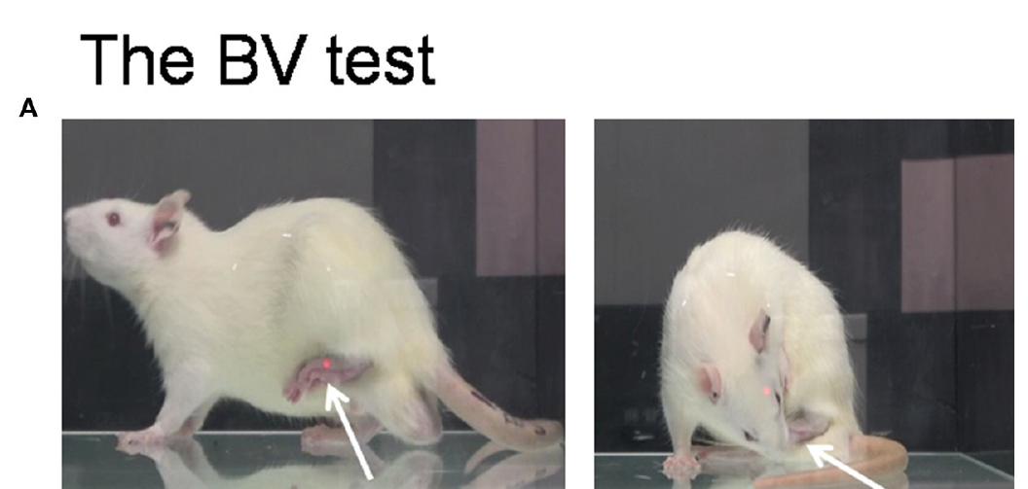
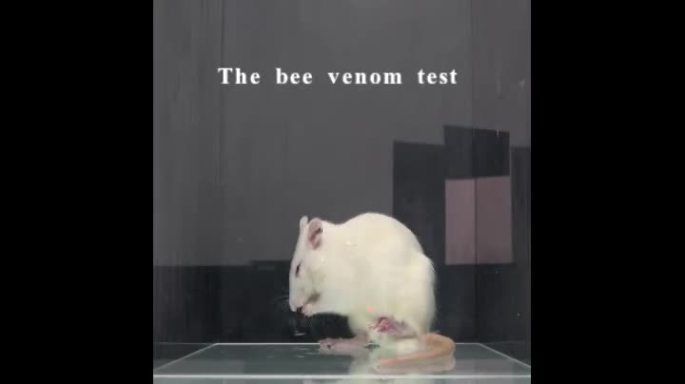
Bee venom produces conspicuous protective paw behavior
The bee venom condition produced localized inflammation in one hind paw. Researchers injected 0.2 mg of venom in 50 μL of saline. The demonstrator repeatedly flinched, lifted, and licked the treated paw. Weight bearing on that side was reduced during the early observation period. These ongoing behaviors provided a familiar observer with a conspicuous indication of the affected body region.
Spontaneous pain-related behavior occurs without a separate test stimulus being applied. It differs from an evoked withdrawal measured with a filament. The early venom response lasted approximately 1 h in this preparation. A later phase retained mechanical hypersensitivity despite reduced visible licking and flinching. The same treated animal could therefore supply very different social cues at different times after injection.
Supplemental Video 1 contains a separate bee venom sequence. The recording preserves the animal’s posture, licking, and movement around its treated paw. The observer experiment paired this condition with subsequent mechanical testing. Both observer hind paws became more sensitive after the brief interaction. The bilateral observer response contrasts with the demonstrator’s initially localized injection and supports a socially induced change in sensitivity.
Li et al. (2018), Fig. 1A. Paw lifting and licking after bee venom treatment.
Li et al. (2018), Supplemental Video 1. Bee venom paw-directed behavior.
Li et al. (2018)
03
Notes:
• The bee venom condition produced localized inflammation in one hind paw. Researchers injected 0.2 mg of venom in 50 μL of saline. The demonstrator repeatedly flinched, lifted, and licked the treated paw. Weight bearing on that side was reduced during the early observation period. These ongoing behaviors provided a familiar observer with a conspicuous indication of the affected body region.
• **Spontaneous pain-related behavior** occurs without a separate test stimulus being applied. It differs from an evoked withdrawal measured with a filament. The early venom response lasted approximately 1 h in this preparation. A later phase retained mechanical hypersensitivity despite reduced visible licking and flinching. The same treated animal could therefore supply very different social cues at different times after injection.
• Supplemental Video 1 contains a separate bee venom sequence. The recording preserves the animal’s posture, licking, and movement around its treated paw. The observer experiment paired this condition with subsequent mechanical testing. Both observer hind paws became more sensitive after the brief interaction. The bilateral observer response contrasts with the demonstrator’s initially localized injection and supports a socially induced change in sensitivity.
References:
Li CL, Yu Y, He T, Wang RR, Geng KW, Du R, Luo WJ, Wei N, Wang XL, Wang Y, Yang Y, Yu YQ, Chen J. (2018). Validating Rat Model of Empathy for Pain: Effects of Pain Expressions in Social Partners. Frontiers in behavioral neuroscience 12:242. https://doi.org/10.3389/fnbeh.2018.00242
Figure: Li et al. (2018), Fig. 1A. Paw lifting and licking after bee venom treatment.
Figure source: https://doi.org/10.3389/fnbeh.2018.00242
Embedded video: Li et al. (2018), Supplemental Video 1. Bee venom paw-directed behavior.
Exact source identifier: Supplemental Video 1
Article DOI: https://doi.org/10.3389/fnbeh.2018.00242
Original media URL: https://pmc-oa-opendata.s3.amazonaws.com/PMC6199527.1/Video_1.MP4
Credit: Li CL, Yu Y, He T, Wang RR, Geng KW, Du R, Luo WJ, Wei N, Wang XL, Wang Y, Yang Y, Yu YQ, Chen J. License: CC BY 4.0.
H.264/AAC compatibility conversion at original speed; original audio preserved; condition-specific excerpt 12–27 seconds of original recording. Poster is a source frame. Playback is full screen where the viewer supports it. Desktop PowerPoint GUI playback and Google Slides import remain untested. Google Slides may require separate Drive media insertion.

Slide 4
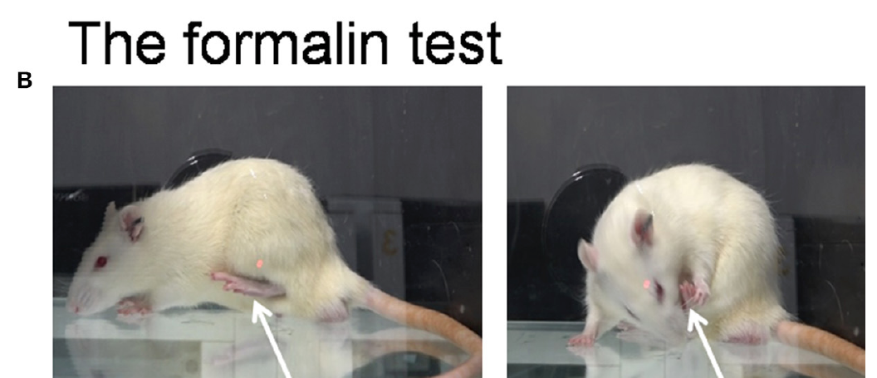
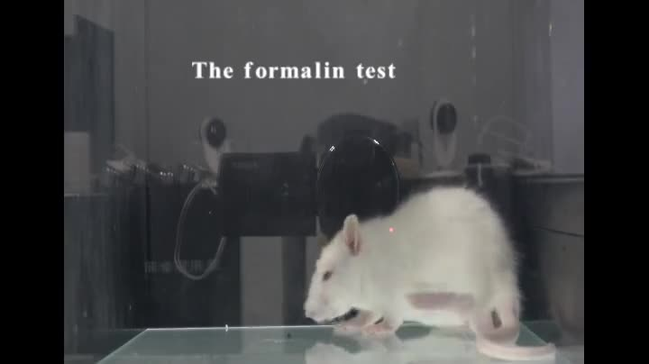
Formalin has distinct early and late behavioral phases
Formalin is a chemical irritant used here to produce sustained paw-directed behavior. The researchers injected a 2.5% solution into one hind paw. Demonstrators lifted and licked that paw and displayed repeated flinches. The treated paw supported less body weight during the conspicuous response. Supplemental Video 1 contains an independently identifiable recording of this experimental condition.
The response had an early phase during the first 10 min. A relatively quiet interval occurred between 11 and 20 min. Paw-directed behavior increased again during the later phase, beginning around 21 min. These temporal changes distinguish this preparation from the more continuous early venom response. An observer’s exposure can thus contain changing behavioral signals even when the treatment remains the same.
Familiar observers developed mechanical hypersensitivity after 30 min with a formalin-treated demonstrator. The measurement was made in the observer’s own paws after social interaction. Control pairs interacting without an affected partner retained more stable thresholds. The investigators could compare two visibly expressive conditions with a less expressive inflammatory condition. This comparison links social exposure to measurable changes in the observer’s subsequent nociceptive responsiveness.
Li et al. (2018), Fig. 1B. Paw-directed behavior in the formalin condition.
Li et al. (2018), Supplemental Video 1. Formalin paw-directed behavior.
Li et al. (2018)
04
Notes:
• **Formalin** is a chemical irritant used here to produce sustained paw-directed behavior. The researchers injected a 2.5% solution into one hind paw. Demonstrators lifted and licked that paw and displayed repeated flinches. The treated paw supported less body weight during the conspicuous response. Supplemental Video 1 contains an independently identifiable recording of this experimental condition.
• The response had an early phase during the first 10 min. A relatively quiet interval occurred between 11 and 20 min. Paw-directed behavior increased again during the later phase, beginning around 21 min. These temporal changes distinguish this preparation from the more continuous early venom response. An observer’s exposure can thus contain changing behavioral signals even when the treatment remains the same.
• Familiar observers developed mechanical hypersensitivity after 30 min with a formalin-treated demonstrator. The measurement was made in the observer’s own paws after social interaction. Control pairs interacting without an affected partner retained more stable thresholds. The investigators could compare two visibly expressive conditions with a less expressive inflammatory condition. This comparison links social exposure to measurable changes in the observer’s subsequent nociceptive responsiveness.
References:
Li CL, Yu Y, He T, Wang RR, Geng KW, Du R, Luo WJ, Wei N, Wang XL, Wang Y, Yang Y, Yu YQ, Chen J. (2018). Validating Rat Model of Empathy for Pain: Effects of Pain Expressions in Social Partners. Frontiers in behavioral neuroscience 12:242. https://doi.org/10.3389/fnbeh.2018.00242
Figure: Li et al. (2018), Fig. 1B. Paw-directed behavior in the formalin condition.
Figure source: https://doi.org/10.3389/fnbeh.2018.00242
Embedded video: Li et al. (2018), Supplemental Video 1. Formalin paw-directed behavior.
Exact source identifier: Supplemental Video 1
Article DOI: https://doi.org/10.3389/fnbeh.2018.00242
Original media URL: https://pmc-oa-opendata.s3.amazonaws.com/PMC6199527.1/Video_1.MP4
Credit: Li CL, Yu Y, He T, Wang RR, Geng KW, Du R, Luo WJ, Wei N, Wang XL, Wang Y, Yang Y, Yu YQ, Chen J. License: CC BY 4.0.
H.264/AAC compatibility conversion at original speed; original audio preserved; condition-specific excerpt 33–49 seconds of original recording. Poster is a source frame. Playback is full screen where the viewer supports it. Desktop PowerPoint GUI playback and Google Slides import remain untested. Google Slides may require separate Drive media insertion.

Slide 5
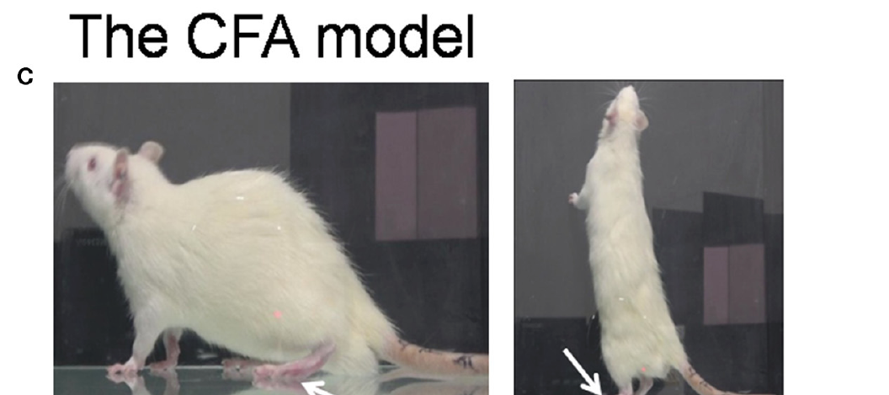
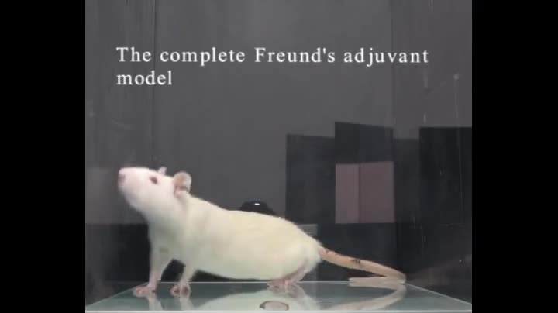
Inflammation can persist with little spontaneous display
Complete Freund’s adjuvant, or CFA, produces an inflammatory condition in the treated paw. Unlike the early venom and formalin conditions, CFA elicited comparatively little spontaneous flinching and licking. The paw nevertheless became swollen and sensitive to later stimulation. Demonstrators could stand and bear weight through the affected paw. Supplemental Video 1 records this less conspicuous behavioral condition separately.
An evoked response is measured after an investigator applies a defined stimulus. Spontaneous display and evoked sensitivity therefore describe different properties of the same animal. A demonstrator can have a reduced mechanical threshold while remaining relatively mobile. Little licking can coexist with increased nociceptive sensitivity. This distinction changes which signals an observer receives during a short encounter.
After 30 min, observers exposed to CFA-treated demonstrators showed a weaker immediate transfer pattern than observers exposed to expressive treatments. Longer co-housing nevertheless produced observer hypersensitivity in the CFA condition. Duration of exposure therefore changes the relationship between demonstrator display and observer response. Repeated proximity supplies information that a brief encounter may not provide. The experiment connects signal availability with the timescale of socially altered sensitivity.
Li et al. (2018), Fig. 1C. Weight bearing after complete Freund’s adjuvant.
Li et al. (2018), Supplemental Video 1. CFA condition with relatively little spontaneous display.
Li et al. (2018)
05
Notes:
• **Complete Freund’s adjuvant**, or CFA, produces an inflammatory condition in the treated paw. Unlike the early venom and formalin conditions, CFA elicited comparatively little spontaneous flinching and licking. The paw nevertheless became swollen and sensitive to later stimulation. Demonstrators could stand and bear weight through the affected paw. Supplemental Video 1 records this less conspicuous behavioral condition separately.
• An **evoked response** is measured after an investigator applies a defined stimulus. Spontaneous display and evoked sensitivity therefore describe different properties of the same animal. A demonstrator can have a reduced mechanical threshold while remaining relatively mobile. Little licking can coexist with increased nociceptive sensitivity. This distinction changes which signals an observer receives during a short encounter.
• After 30 min, observers exposed to CFA-treated demonstrators showed a weaker immediate transfer pattern than observers exposed to expressive treatments. Longer co-housing nevertheless produced observer hypersensitivity in the CFA condition. Duration of exposure therefore changes the relationship between demonstrator display and observer response. Repeated proximity supplies information that a brief encounter may not provide. The experiment connects signal availability with the timescale of socially altered sensitivity.
References:
Li CL, Yu Y, He T, Wang RR, Geng KW, Du R, Luo WJ, Wei N, Wang XL, Wang Y, Yang Y, Yu YQ, Chen J. (2018). Validating Rat Model of Empathy for Pain: Effects of Pain Expressions in Social Partners. Frontiers in behavioral neuroscience 12:242. https://doi.org/10.3389/fnbeh.2018.00242
Figure: Li et al. (2018), Fig. 1C. Weight bearing after complete Freund’s adjuvant.
Figure source: https://doi.org/10.3389/fnbeh.2018.00242
Embedded video: Li et al. (2018), Supplemental Video 1. CFA condition with relatively little spontaneous display.
Exact source identifier: Supplemental Video 1
Article DOI: https://doi.org/10.3389/fnbeh.2018.00242
Original media URL: https://pmc-oa-opendata.s3.amazonaws.com/PMC6199527.1/Video_1.MP4
Credit: Li CL, Yu Y, He T, Wang RR, Geng KW, Du R, Luo WJ, Wei N, Wang XL, Wang Y, Yang Y, Yu YQ, Chen J. License: CC BY 4.0.
H.264/AAC compatibility conversion at original speed; original audio preserved; condition-specific excerpt 52–62 seconds of original recording. Poster is a source frame. Playback is full screen where the viewer supports it. Desktop PowerPoint GUI playback and Google Slides import remain untested. Google Slides may require separate Drive media insertion.

Slide 6
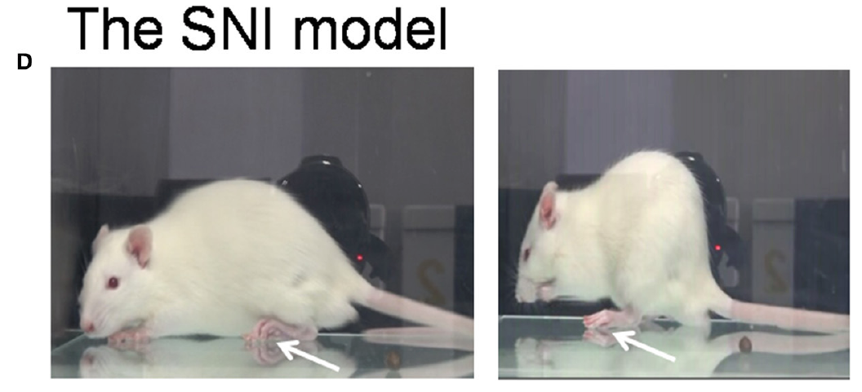
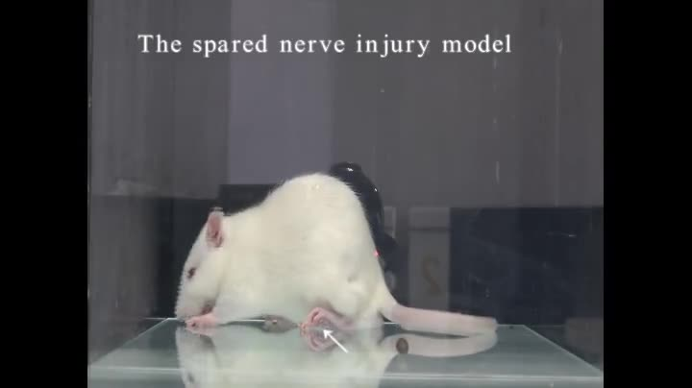
Nerve injury changes sensitivity without a vivid display
Spared nerve injury, or SNI, is a neuropathic preparation affecting selected branches of the sciatic nerve. The tibial and common peroneal branches were interrupted while the sural branch remained intact. Neuropathic describes a condition arising from damage to the somatosensory nervous system. The demonstrator developed altered paw posture and mechanical hypersensitivity after surgery. Supplemental Video 1 records this condition separately from the inflammatory treatments.
Mechanical sensitivity increased over days rather than being inferred from one visible reaction. The study followed the injured animals through a 14-day interval. Demonstrators displayed relatively little spontaneous flinching or sustained paw licking during ordinary movement. Their appearance therefore differed from rats in the early venom condition. A controlled stimulus was necessary to characterize the ongoing change in threshold.
Pain-free rats co-housed with SNI demonstrators also developed mechanical hypersensitivity over the extended observation period. Comparable control pairs did not follow the same time course. This extended transfer occurred without the vivid early display associated with venom. Rats can therefore acquire altered responsiveness through prolonged social exposure to a less visibly expressive partner. The result separates immediate behavioral contagion from an adaptation developing across repeated encounters.
Li et al. (2018), Fig. 1D. A rat in the spared nerve injury condition.
Li et al. (2018), Supplemental Video 1. Spared nerve injury condition.
Li et al. (2018)
06
Notes:
• **Spared nerve injury**, or SNI, is a neuropathic preparation affecting selected branches of the sciatic nerve. The tibial and common peroneal branches were interrupted while the sural branch remained intact. **Neuropathic** describes a condition arising from damage to the somatosensory nervous system. The demonstrator developed altered paw posture and mechanical hypersensitivity after surgery. Supplemental Video 1 records this condition separately from the inflammatory treatments.
• Mechanical sensitivity increased over days rather than being inferred from one visible reaction. The study followed the injured animals through a 14-day interval. Demonstrators displayed relatively little spontaneous flinching or sustained paw licking during ordinary movement. Their appearance therefore differed from rats in the early venom condition. A controlled stimulus was necessary to characterize the ongoing change in threshold.
• Pain-free rats co-housed with SNI demonstrators also developed mechanical hypersensitivity over the extended observation period. Comparable control pairs did not follow the same time course. This extended transfer occurred without the vivid early display associated with venom. Rats can therefore acquire altered responsiveness through prolonged social exposure to a less visibly expressive partner. The result separates immediate behavioral contagion from an adaptation developing across repeated encounters.
References:
Li CL, Yu Y, He T, Wang RR, Geng KW, Du R, Luo WJ, Wei N, Wang XL, Wang Y, Yang Y, Yu YQ, Chen J. (2018). Validating Rat Model of Empathy for Pain: Effects of Pain Expressions in Social Partners. Frontiers in behavioral neuroscience 12:242. https://doi.org/10.3389/fnbeh.2018.00242
Figure: Li et al. (2018), Fig. 1D. A rat in the spared nerve injury condition.
Figure source: https://doi.org/10.3389/fnbeh.2018.00242
Embedded video: Li et al. (2018), Supplemental Video 1. Spared nerve injury condition.
Exact source identifier: Supplemental Video 1
Article DOI: https://doi.org/10.3389/fnbeh.2018.00242
Original media URL: https://pmc-oa-opendata.s3.amazonaws.com/PMC6199527.1/Video_1.MP4
Credit: Li CL, Yu Y, He T, Wang RR, Geng KW, Du R, Luo WJ, Wei N, Wang XL, Wang Y, Yang Y, Yu YQ, Chen J. License: CC BY 4.0.
H.264/AAC compatibility conversion at original speed; original audio preserved; condition-specific excerpt 65–77 seconds of original recording. Poster is a source frame. Playback is full screen where the viewer supports it. Desktop PowerPoint GUI playback and Google Slides import remain untested. Google Slides may require separate Drive media insertion.

Slide 7
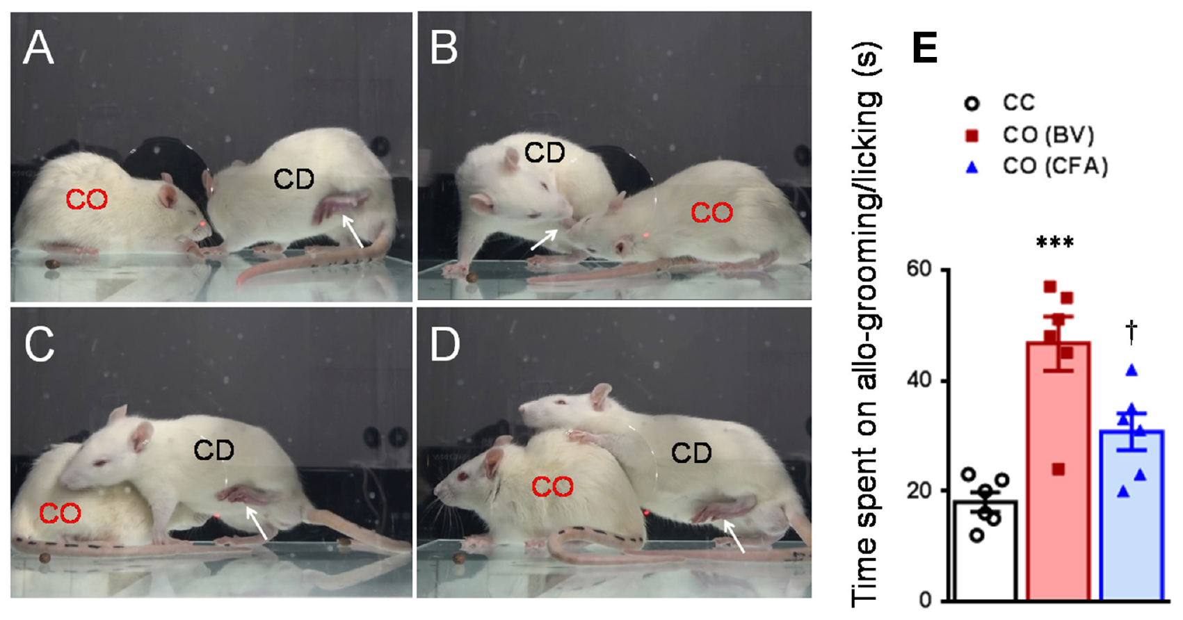
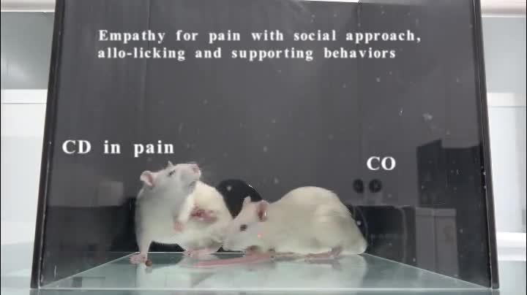
Familiar rats direct contact toward an affected partner
The rat dyads had shared a home cage for at least 2 weeks. Researchers reunited a pain-free observer with its treated partner in a separate testing box. Observers approached the demonstrator and contacted its body. They also directed licking toward the injured paw and sometimes supported the partner’s body. Supplemental Video 2 records these interactions during the priming encounter.
Allogrooming is grooming directed toward another individual rather than oneself. Allolicking in this study meant contact with the injured paw accompanied by rhythmic head movement. The investigators distinguished these behaviors from anogenital or tail grooming. This behavioral definition localized the response to the demonstrator’s affected region. It allowed partner-directed actions to be measured separately from general social exploration.
Observers spent more time grooming or licking venom-treated demonstrators than untreated control partners. The CFA condition elicited less of this conspicuous contact than the venom condition. Partner-directed behavior and the observer’s own hypersensitivity were both assessed in the experiment. They are distinct outcomes of the same encounter. Social exposure can therefore affect how an animal acts toward another and how it responds to subsequent stimulation itself.
Li et al. (2018), Fig. 2A–E. Social approach, paw-directed licking, and body support.
Li et al. (2018), Supplemental Video 2. Familiar rat social interaction and injured-paw contact.
Li et al. (2018)
07
Notes:
• The rat dyads had shared a home cage for at least 2 weeks. Researchers reunited a pain-free observer with its treated partner in a separate testing box. Observers approached the demonstrator and contacted its body. They also directed licking toward the injured paw and sometimes supported the partner’s body. Supplemental Video 2 records these interactions during the priming encounter.
• **Allogrooming** is grooming directed toward another individual rather than oneself. **Allolicking** in this study meant contact with the injured paw accompanied by rhythmic head movement. The investigators distinguished these behaviors from anogenital or tail grooming. This behavioral definition localized the response to the demonstrator’s affected region. It allowed partner-directed actions to be measured separately from general social exploration.
• Observers spent more time grooming or licking venom-treated demonstrators than untreated control partners. The CFA condition elicited less of this conspicuous contact than the venom condition. Partner-directed behavior and the observer’s own hypersensitivity were both assessed in the experiment. They are distinct outcomes of the same encounter. Social exposure can therefore affect how an animal acts toward another and how it responds to subsequent stimulation itself.
References:
Li CL, Yu Y, He T, Wang RR, Geng KW, Du R, Luo WJ, Wei N, Wang XL, Wang Y, Yang Y, Yu YQ, Chen J. (2018). Validating Rat Model of Empathy for Pain: Effects of Pain Expressions in Social Partners. Frontiers in behavioral neuroscience 12:242. https://doi.org/10.3389/fnbeh.2018.00242
Figure: Li et al. (2018), Fig. 2A–E. Social approach, paw-directed licking, and body support.
Figure source: https://doi.org/10.3389/fnbeh.2018.00242
Embedded video: Li et al. (2018), Supplemental Video 2. Familiar rat social interaction and injured-paw contact.
Exact source identifier: Supplemental Video 2
Article DOI: https://doi.org/10.3389/fnbeh.2018.00242
Original media URL: https://pmc-oa-opendata.s3.amazonaws.com/PMC6199527.1/Video_2.MP4
Credit: Li CL, Yu Y, He T, Wang RR, Geng KW, Du R, Luo WJ, Wei N, Wang XL, Wang Y, Yang Y, Yu YQ, Chen J. License: CC BY 4.0.
H.264/AAC compatibility conversion at original speed; original audio preserved; full recording retained. Poster is a source frame. Playback is full screen where the viewer supports it. Desktop PowerPoint GUI playback and Google Slides import remain untested. Google Slides may require separate Drive media insertion.

Slide 8
Visible display predicts short-encounter transfer
The investigators compared demonstrator flinches and licking during the same 30-min interaction window. Venom and formalin produced pronounced spontaneous display. CFA produced fewer such behaviors during that interval. This comparison held the social encounter duration constant while changing the demonstrator preparation. The observer’s mechanical threshold was then followed for several hours after the encounter.
Observers exposed to venom or formalin developed bilateral mechanical hypersensitivity. Thresholds gradually recovered during the subsequent testing period. Exposure to a pain-free cagemate did not produce the corresponding response. The short CFA encounter produced a smaller transfer pattern. The outcome followed the availability of conspicuous behavior more closely than a simple classification of whether the demonstrator was injured.
A late venom encounter provided a further temporal control. At 2 h after injection, the demonstrator retained evoked hypersensitivity but displayed little ongoing licking. Observers did not develop the same threshold reduction after that encounter. The comparison changes the behavioral signal without changing the identity of the irritant. It connects the timing of social exposure with the expression of the demonstrator’s state.
Li et al. (2018), Fig. 2A. A familiar observer and demonstrator.
Li et al. (2018), Fig. 3A–F. Pain expression and post-interaction threshold time courses.
Li et al. (2018)
08
Notes:
• The investigators compared demonstrator flinches and licking during the same 30-min interaction window. Venom and formalin produced pronounced spontaneous display. CFA produced fewer such behaviors during that interval. This comparison held the social encounter duration constant while changing the demonstrator preparation. The observer’s mechanical threshold was then followed for several hours after the encounter.
• Observers exposed to venom or formalin developed bilateral mechanical hypersensitivity. Thresholds gradually recovered during the subsequent testing period. Exposure to a pain-free cagemate did not produce the corresponding response. The short CFA encounter produced a smaller transfer pattern. The outcome followed the availability of conspicuous behavior more closely than a simple classification of whether the demonstrator was injured.
• A late venom encounter provided a further temporal control. At 2 h after injection, the demonstrator retained evoked hypersensitivity but displayed little ongoing licking. Observers did not develop the same threshold reduction after that encounter. The comparison changes the behavioral signal without changing the identity of the irritant. It connects the timing of social exposure with the expression of the demonstrator’s state.
References:
Li CL, Yu Y, He T, Wang RR, Geng KW, Du R, Luo WJ, Wei N, Wang XL, Wang Y, Yang Y, Yu YQ, Chen J. (2018). Validating Rat Model of Empathy for Pain: Effects of Pain Expressions in Social Partners. Frontiers in behavioral neuroscience 12:242. https://doi.org/10.3389/fnbeh.2018.00242
Figure: Li et al. (2018), Fig. 3A–F. Pain expression and post-interaction threshold time courses.
Figure source: https://doi.org/10.3389/fnbeh.2018.00242
Figure: Li et al. (2018), Fig. 2A. A familiar observer and demonstrator.
Figure source: https://doi.org/10.3389/fnbeh.2018.00242

Slide 9
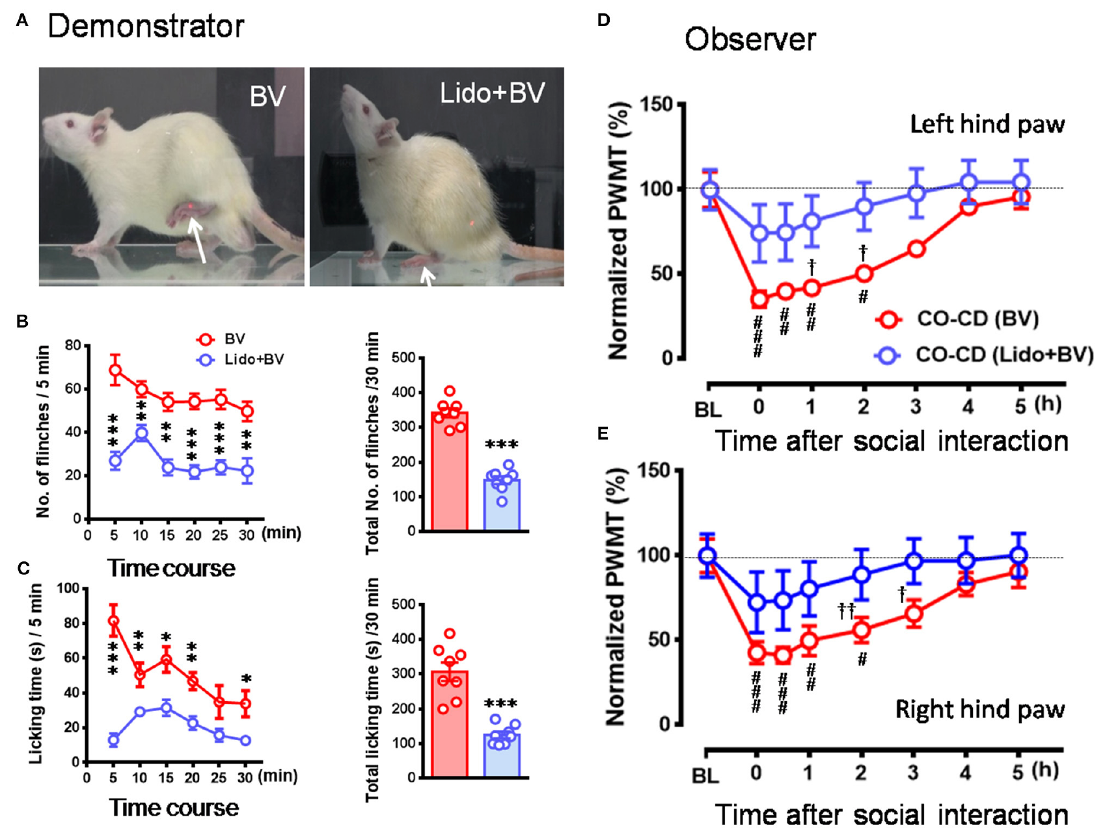
Local analgesia reduces the signal available to observers
Lidocaine is a local anesthetic used to suppress nociceptive input from the treated paw. The researchers administered it with venom in the demonstrator. This reduced the demonstrator’s paw flinches and licking during the social encounter. Observers were still paired with a familiar animal that had received the venom treatment. The intervention therefore altered the demonstrator’s expressed condition before measuring the observer’s response.
Observers encountering the locally analgesized demonstrator showed less mechanical hypersensitivity than observers encountering the untreated venom condition. The difference occurred in both observer hind paws. Mechanical thresholds were followed repeatedly after social interaction. The reduction accompanied the loss of conspicuous demonstrator behavior. A manipulation at the demonstrator’s injury site thus changed the sensory and behavioral input reaching the observer.
The anesthetic comparison complements the late venom encounter. Both conditions weakened ongoing display despite a history of tissue-directed treatment. Their observers consequently showed reduced short-encounter transfer. Pain-free social controls retained their usual mechanical responsiveness. These converging controls connect current demonstrator signals to socially induced sensitivity rather than the injection procedure alone.
Li et al. (2018), Fig. 2A. A familiar observer and demonstrator.
Li et al. (2018), Fig. 5A–E. Lidocaine reduces demonstrator display and observer hypersensitivity.
Li et al. (2018)
09
Notes:
• **Lidocaine** is a local anesthetic used to suppress nociceptive input from the treated paw. The researchers administered it with venom in the demonstrator. This reduced the demonstrator’s paw flinches and licking during the social encounter. Observers were still paired with a familiar animal that had received the venom treatment. The intervention therefore altered the demonstrator’s expressed condition before measuring the observer’s response.
• Observers encountering the locally analgesized demonstrator showed less mechanical hypersensitivity than observers encountering the untreated venom condition. The difference occurred in both observer hind paws. Mechanical thresholds were followed repeatedly after social interaction. The reduction accompanied the loss of conspicuous demonstrator behavior. A manipulation at the demonstrator’s injury site thus changed the sensory and behavioral input reaching the observer.
• The anesthetic comparison complements the late venom encounter. Both conditions weakened ongoing display despite a history of tissue-directed treatment. Their observers consequently showed reduced short-encounter transfer. Pain-free social controls retained their usual mechanical responsiveness. These converging controls connect current demonstrator signals to socially induced sensitivity rather than the injection procedure alone.
References:
Li CL, Yu Y, He T, Wang RR, Geng KW, Du R, Luo WJ, Wei N, Wang XL, Wang Y, Yang Y, Yu YQ, Chen J. (2018). Validating Rat Model of Empathy for Pain: Effects of Pain Expressions in Social Partners. Frontiers in behavioral neuroscience 12:242. https://doi.org/10.3389/fnbeh.2018.00242
Figure: Li et al. (2018), Fig. 5A–E. Lidocaine reduces demonstrator display and observer hypersensitivity.
Figure source: https://doi.org/10.3389/fnbeh.2018.00242
Figure: Li et al. (2018), Fig. 2A. A familiar observer and demonstrator.
Figure source: https://doi.org/10.3389/fnbeh.2018.00242

Slide 10
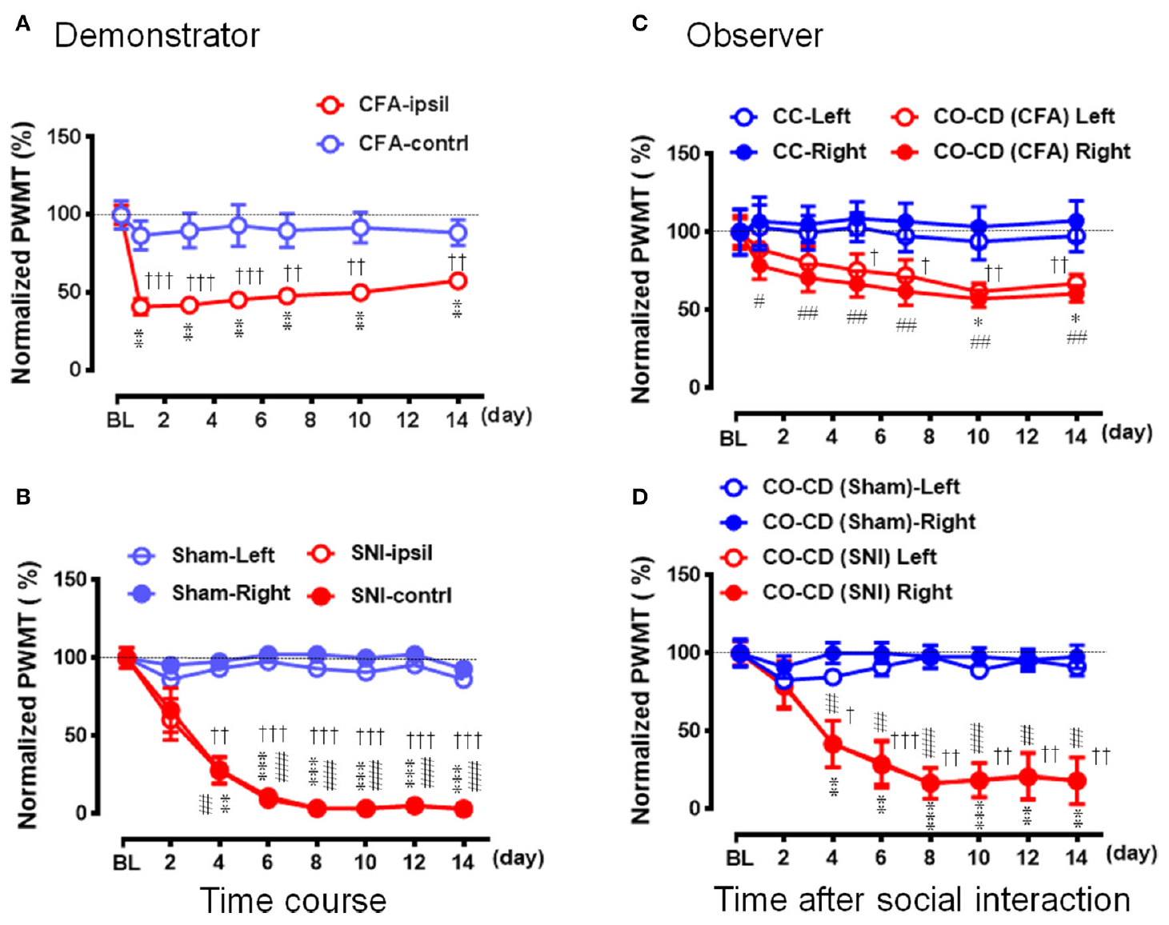
Extended co-housing transfers less conspicuous conditions
The extended experiment followed familiar pairs for 14 days. One rat received CFA or spared nerve injury, while its partner remained untreated. Mechanical thresholds were measured repeatedly in both animals. Control pairs contained untreated or sham-operated demonstrators. This design examined a longer period than the 30-min priming encounter used for immediate transfer.
CFA demonstrators developed localized mechanical hypersensitivity in the injected hind paw. Their untreated partners later acquired bilateral hypersensitivity. SNI demonstrators also developed a persistent threshold reduction. Observers co-housed with them followed a delayed sensitization pattern. The temporal relationship distinguishes prolonged social adaptation from an observer merely copying a movement at the moment it occurs.
Repeated exposure can supply cues that are weak during an isolated encounter. The study compared conspicuous early display with less expressive chronic conditions. These conditions affected observers on different timescales. A short absence of obvious licking therefore changes the interpretation of a brief social assay. It does not rule out transfer developing during extended proximity to an affected partner.
Li et al. (2018), Fig. 2A. A familiar observer and demonstrator.
Li et al. (2018), Fig. 7A–D. Demonstrator and observer thresholds during 14-day co-housing.
Li et al. (2018)
10
Notes:
• The extended experiment followed familiar pairs for 14 days. One rat received CFA or spared nerve injury, while its partner remained untreated. Mechanical thresholds were measured repeatedly in both animals. Control pairs contained untreated or sham-operated demonstrators. This design examined a longer period than the 30-min priming encounter used for immediate transfer.
• CFA demonstrators developed localized mechanical hypersensitivity in the injected hind paw. Their untreated partners later acquired bilateral hypersensitivity. SNI demonstrators also developed a persistent threshold reduction. Observers co-housed with them followed a delayed sensitization pattern. The temporal relationship distinguishes prolonged social adaptation from an observer merely copying a movement at the moment it occurs.
• Repeated exposure can supply cues that are weak during an isolated encounter. The study compared conspicuous early display with less expressive chronic conditions. These conditions affected observers on different timescales. A short absence of obvious licking therefore changes the interpretation of a brief social assay. It does not rule out transfer developing during extended proximity to an affected partner.
References:
Li CL, Yu Y, He T, Wang RR, Geng KW, Du R, Luo WJ, Wei N, Wang XL, Wang Y, Yang Y, Yu YQ, Chen J. (2018). Validating Rat Model of Empathy for Pain: Effects of Pain Expressions in Social Partners. Frontiers in behavioral neuroscience 12:242. https://doi.org/10.3389/fnbeh.2018.00242
Figure: Li et al. (2018), Fig. 7A–D. Demonstrator and observer thresholds during 14-day co-housing.
Figure source: https://doi.org/10.3389/fnbeh.2018.00242
Figure: Li et al. (2018), Fig. 2A. A familiar observer and demonstrator.
Figure source: https://doi.org/10.3389/fnbeh.2018.00242

Slide 11
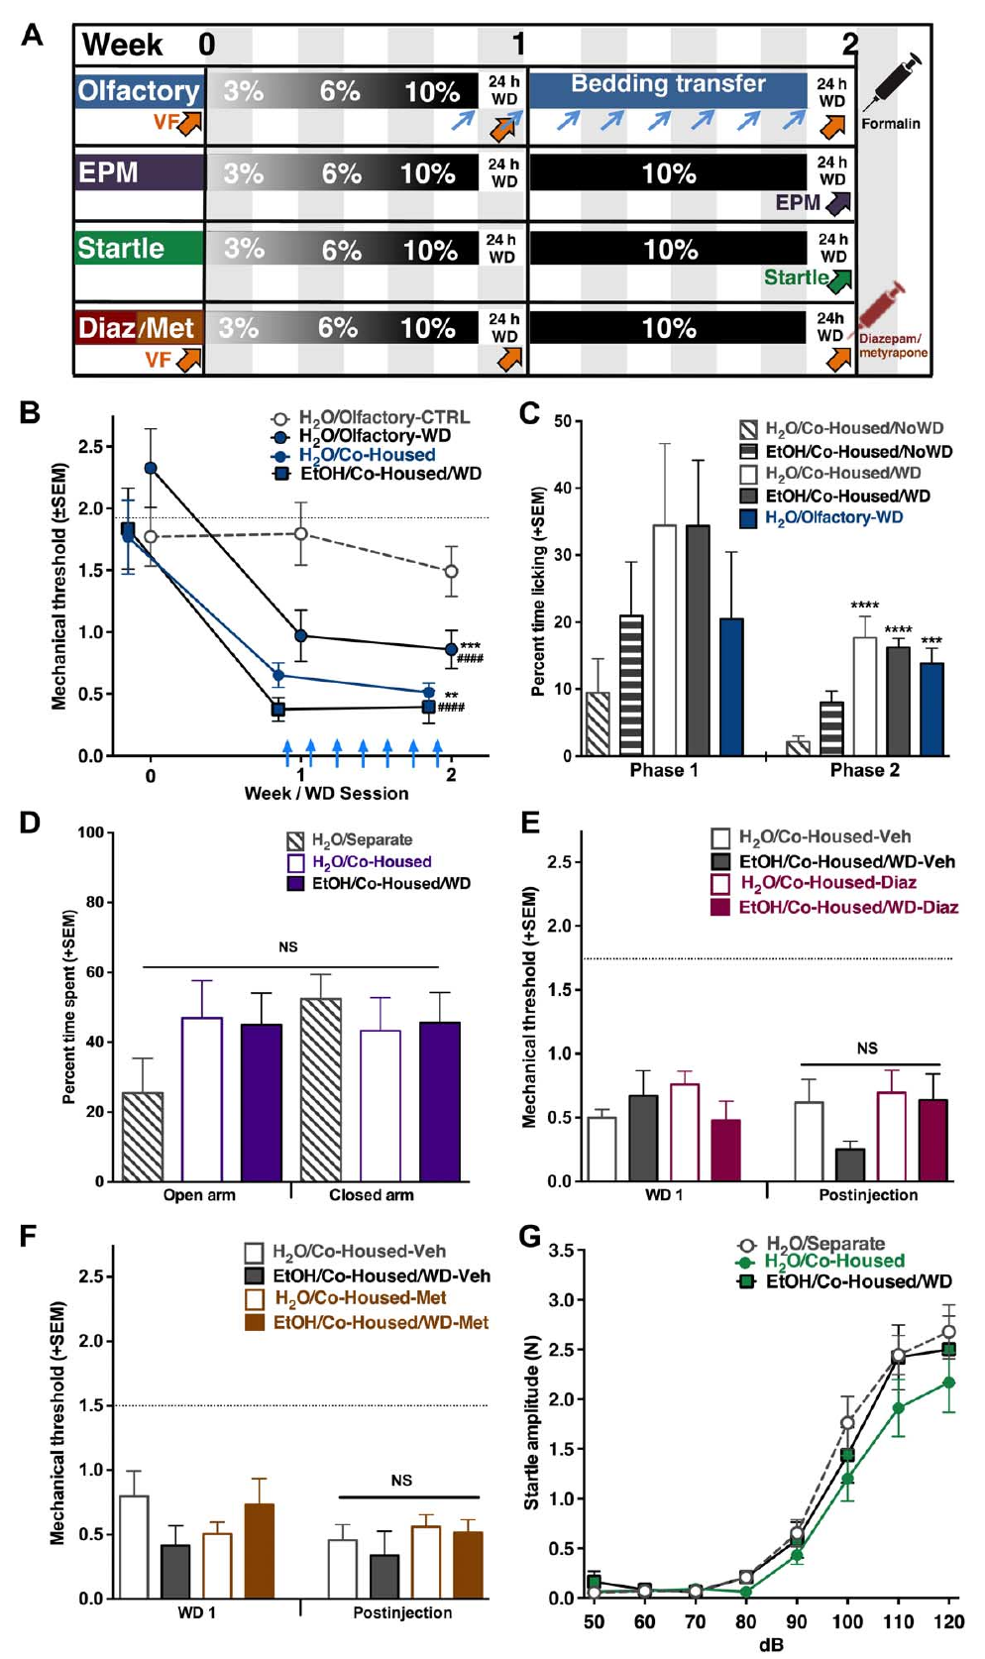
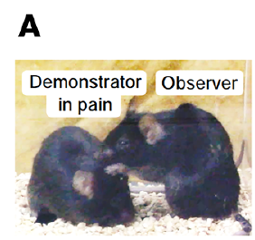
Bedding odors transmit hypersensitivity without contact
Smith and colleagues exposed untreated mice to bedding from hypersensitive animals. The source mice were undergoing alcohol withdrawal and showed reduced mechanical thresholds. Small amounts of their bedding were placed in open cages in another room. The recipient mice had no direct interaction with the source animals. Mechanical hypersensitivity appeared in these otherwise untreated recipients within 24 h.
An olfactory cue is chemical information detected through smell. The bedding manipulation carried the source animals’ odor environment without transferring a social encounter. Bedding from unfamiliar but experimentally untreated mice served as a control. That control did not produce the same reduction in threshold. The relevant signal was therefore associated with the hypersensitive source condition rather than unfamiliar bedding in general.
The experiment measured the recipient’s own response to later stimulation. A shared odor environment can thus alter nociceptive responsiveness outside the original treatment cage. Familiarity with the source animal was not required in the associated bystander experiments. This differs from the brief familiar-rat interaction paradigm. The two preparations identify distinct routes through which social information influences subsequent sensitivity.
Geng et al. (2026), Fig. 1A. The mouse social-interaction preparation.
Smith et al. (2016), Fig. 3A–B. Transfer of bedding and mechanical hypersensitivity in nearby mice.
Smith et al. (2016)
11
Notes:
• Smith and colleagues exposed untreated mice to bedding from hypersensitive animals. The source mice were undergoing alcohol withdrawal and showed reduced mechanical thresholds. Small amounts of their bedding were placed in open cages in another room. The recipient mice had no direct interaction with the source animals. Mechanical hypersensitivity appeared in these otherwise untreated recipients within 24 h.
• An **olfactory cue** is chemical information detected through smell. The bedding manipulation carried the source animals’ odor environment without transferring a social encounter. Bedding from unfamiliar but experimentally untreated mice served as a control. That control did not produce the same reduction in threshold. The relevant signal was therefore associated with the hypersensitive source condition rather than unfamiliar bedding in general.
• The experiment measured the recipient’s own response to later stimulation. A shared odor environment can thus alter nociceptive responsiveness outside the original treatment cage. Familiarity with the source animal was not required in the associated bystander experiments. This differs from the brief familiar-rat interaction paradigm. The two preparations identify distinct routes through which social information influences subsequent sensitivity.
References:
Smith ML, Hostetler CM, Heinricher MM, Ryabinin AE. (2016). Social transfer of pain in mice. Science advances 2(10):e1600855. https://doi.org/10.1126/sciadv.1600855
Geng KW, Wang RR, Yang Y, Wang Y, He T, Li CL, Xu CS, Chen J. (2026). Hypothalamic-amygdala gating of caregiving-like prosocial behavior in mice. The Journal of clinical investigation 136(19):e204317. https://doi.org/10.1172/jci204317
Figure: Smith et al. (2016), Fig. 3A–B. Transfer of bedding and mechanical hypersensitivity in nearby mice.
Figure source: https://doi.org/10.1126/sciadv.1600855
Figure: Geng et al. (2026), Fig. 1A. The mouse social-interaction preparation.
Figure source: https://doi.org/10.1172/jci204317

Slide 12
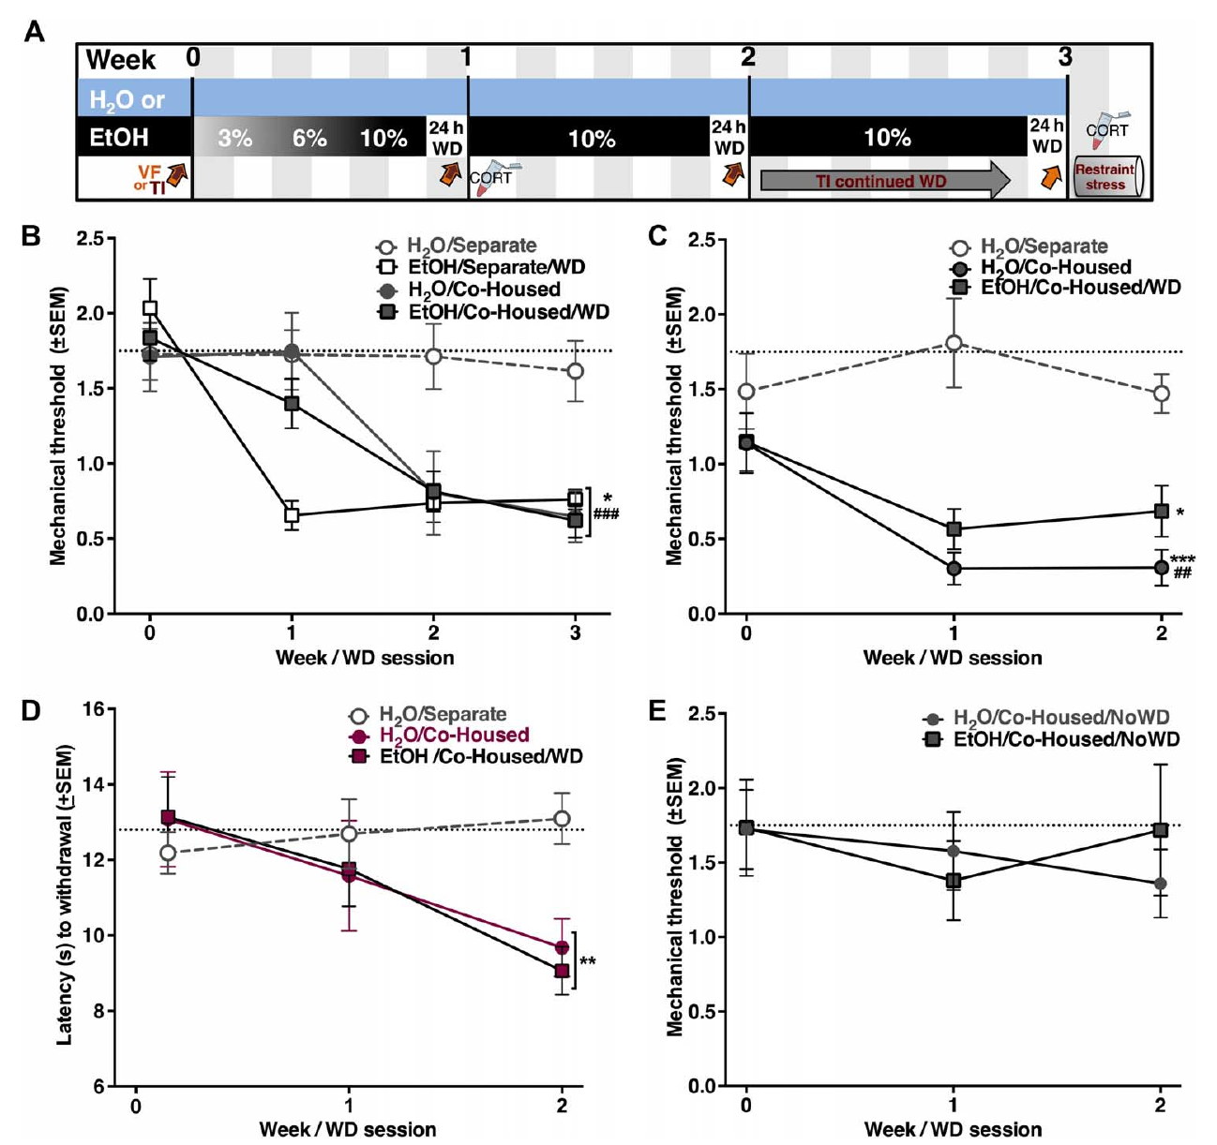
Withdrawal changes the potency of environmental cues
Mice voluntarily consumed ethanol before scheduled periods of withdrawal. Other mice in the same room drank only water. Both alcohol-withdrawn animals and untreated water-drinking bystanders developed mechanical hypersensitivity. Water-drinking controls housed in a separate room retained stable thresholds. The comparison links a room-level social environment with sensitivity in animals never given ethanol.
The source condition depended on withdrawal rather than ethanol odor alone. Continuous ethanol access did not produce the same threshold changes. Both male and female bystanders acquired hypersensitivity during the withdrawal paradigm. Tail immersion at 46 °C also produced shorter withdrawal latencies in the exposed groups. Social transfer therefore extended across the mechanical and thermal measurements used in this study.
After ethanol access ended, mechanical thresholds returned toward baseline over approximately 4 days. Bystander recovery resembled recovery in the source animals. Restoring ethanol access rapidly normalized the source group while bystanders remained hypersensitive. Their responses were consequently not simple moment-to-moment copies of the source animals’ behavior. The environmental signal can initiate a change in the recipient that persists beyond immediate source-state matching.
Geng et al. (2026), Fig. 1A. The mouse social-interaction preparation.
Smith et al. (2016), Fig. 2B–E. Mechanical and thermal sensitivity during alcohol withdrawal.
Smith et al. (2016)
12
Notes:
• Mice voluntarily consumed ethanol before scheduled periods of withdrawal. Other mice in the same room drank only water. Both alcohol-withdrawn animals and untreated water-drinking bystanders developed mechanical hypersensitivity. Water-drinking controls housed in a separate room retained stable thresholds. The comparison links a room-level social environment with sensitivity in animals never given ethanol.
• The source condition depended on withdrawal rather than ethanol odor alone. Continuous ethanol access did not produce the same threshold changes. Both male and female bystanders acquired hypersensitivity during the withdrawal paradigm. Tail immersion at 46 °C also produced shorter withdrawal latencies in the exposed groups. Social transfer therefore extended across the mechanical and thermal measurements used in this study.
• After ethanol access ended, mechanical thresholds returned toward baseline over approximately 4 days. Bystander recovery resembled recovery in the source animals. Restoring ethanol access rapidly normalized the source group while bystanders remained hypersensitive. Their responses were consequently not simple moment-to-moment copies of the source animals’ behavior. The environmental signal can initiate a change in the recipient that persists beyond immediate source-state matching.
References:
Smith ML, Hostetler CM, Heinricher MM, Ryabinin AE. (2016). Social transfer of pain in mice. Science advances 2(10):e1600855. https://doi.org/10.1126/sciadv.1600855
Geng KW, Wang RR, Yang Y, Wang Y, He T, Li CL, Xu CS, Chen J. (2026). Hypothalamic-amygdala gating of caregiving-like prosocial behavior in mice. The Journal of clinical investigation 136(19):e204317. https://doi.org/10.1172/jci204317
Figure: Smith et al. (2016), Fig. 2B–E. Mechanical and thermal sensitivity during alcohol withdrawal.
Figure source: https://doi.org/10.1126/sciadv.1600855
Figure: Geng et al. (2026), Fig. 1A. The mouse social-interaction preparation.
Figure source: https://doi.org/10.1172/jci204317

Slide 13
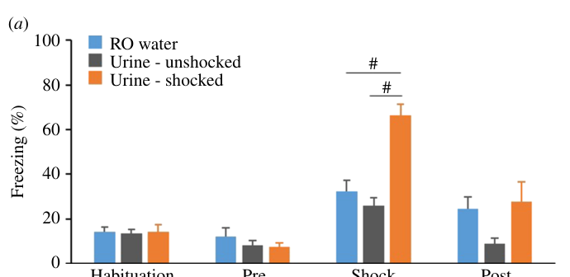
Urine cues alter responses to another mouse’s distress
Nakamura and colleagues presented recorded footage of a mouse receiving foot shocks. Observers were Japanese wild-derived MSM mice rather than the usual B6 laboratory strain. The footage was paired with urine from a shocked mouse, urine from an unshocked mouse, or water. This held the visible scene constant while changing the chemical context. The observer’s response was measured as freezing, an extended reduction in movement apart from respiration.
Observers froze more during the shock footage when exposed to urine from shocked mice. Urine from unshocked mice and water produced weaker responses. The liquid source thus changed the behavioral meaning of the same visual event. The study measured defensive state matching rather than the observer’s mechanical threshold. Freezing and transferred hypersensitivity must therefore remain distinct experimental outcomes.
The observers had no physical contact with the filmed demonstrator. The preparation separated social signals from live reciprocal interaction. Urine and visible behavior together supplied enough information to elicit the measured response. The specific chemical component was not isolated in this experiment. The result establishes a combined sensory route for responding to another animal’s noxious experience, rather than identifying a single universal pain odor.
Nakamura et al. (2024), Fig. 4a. Freezing during footage paired with different urine conditions.
Nakamura et al. (2024)
13
Notes:
• Nakamura and colleagues presented recorded footage of a mouse receiving foot shocks. Observers were Japanese wild-derived MSM mice rather than the usual B6 laboratory strain. The footage was paired with urine from a shocked mouse, urine from an unshocked mouse, or water. This held the visible scene constant while changing the chemical context. The observer’s response was measured as **freezing**, an extended reduction in movement apart from respiration.
• Observers froze more during the shock footage when exposed to urine from shocked mice. Urine from unshocked mice and water produced weaker responses. The liquid source thus changed the behavioral meaning of the same visual event. The study measured defensive state matching rather than the observer’s mechanical threshold. Freezing and transferred hypersensitivity must therefore remain distinct experimental outcomes.
• The observers had no physical contact with the filmed demonstrator. The preparation separated social signals from live reciprocal interaction. Urine and visible behavior together supplied enough information to elicit the measured response. The specific chemical component was not isolated in this experiment. The result establishes a combined sensory route for responding to another animal’s noxious experience, rather than identifying a single universal pain odor.
References:
Nakamura M, Nomoto K, Mogi K, Koide T, Kikusui T. (2024). Visual and olfactory signals of conspecifics induce emotional contagion in mice. Proceedings. Biological sciences 291(2036):20241815. https://doi.org/10.1098/rspb.2024.1815
Figure: Nakamura et al. (2024), Fig. 4a. Freezing during footage paired with different urine conditions.
Figure source: https://doi.org/10.1098/rspb.2024.1815

Slide 14
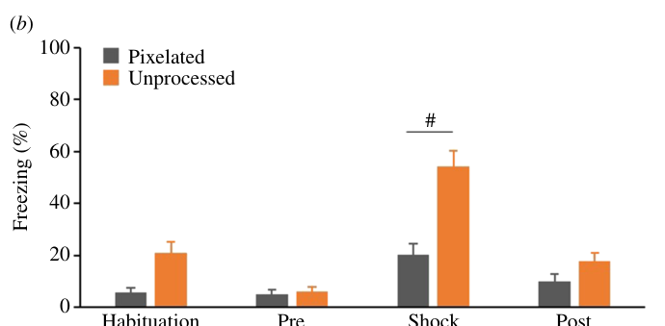
Degrading visible behavior weakens distress matching
The investigators altered the visible information in the recorded demonstrator footage. One observer group viewed the original recording and another viewed a pixelated version. Both groups received the shocked-urine cue used in the chemical comparison. Pixelation reduced recognizable details of the demonstrator’s movement and form. The manipulation tested the contribution of visual information while retaining the same broad social context.
MSM observers froze more during the original footage than during the pixelated footage. The difference was clearest during the shock period. This associates recognizable visual behavior with the observer’s defensive response. It complements the urine manipulation, which changed chemical context while preserving the original image. Together the experiments identify interacting sensory inputs rather than assigning the response exclusively to vision or smell.
The initial live-observation comparison also found stronger freezing in MSM than in B6 observers. Demonstrator freezing did not differ comparably between those pairings. Observer genotype therefore contributed to responsiveness to the same type of social event. Sensory access and observer characteristics can each alter state matching. Results from one laboratory strain consequently describe that tested population rather than a uniform response of all mice.
Nakamura et al. (2024), Fig. 4b. Freezing with pixelated versus unprocessed footage.
Nakamura et al. (2024)
14
Notes:
• The investigators altered the visible information in the recorded demonstrator footage. One observer group viewed the original recording and another viewed a pixelated version. Both groups received the shocked-urine cue used in the chemical comparison. Pixelation reduced recognizable details of the demonstrator’s movement and form. The manipulation tested the contribution of visual information while retaining the same broad social context.
• MSM observers froze more during the original footage than during the pixelated footage. The difference was clearest during the shock period. This associates recognizable visual behavior with the observer’s defensive response. It complements the urine manipulation, which changed chemical context while preserving the original image. Together the experiments identify interacting sensory inputs rather than assigning the response exclusively to vision or smell.
• The initial live-observation comparison also found stronger freezing in MSM than in B6 observers. Demonstrator freezing did not differ comparably between those pairings. Observer genotype therefore contributed to responsiveness to the same type of social event. Sensory access and observer characteristics can each alter state matching. Results from one laboratory strain consequently describe that tested population rather than a uniform response of all mice.
References:
Nakamura M, Nomoto K, Mogi K, Koide T, Kikusui T. (2024). Visual and olfactory signals of conspecifics induce emotional contagion in mice. Proceedings. Biological sciences 291(2036):20241815. https://doi.org/10.1098/rspb.2024.1815
Figure: Nakamura et al. (2024), Fig. 4b. Freezing with pixelated versus unprocessed footage.
Figure source: https://doi.org/10.1098/rspb.2024.1815

Slide 15
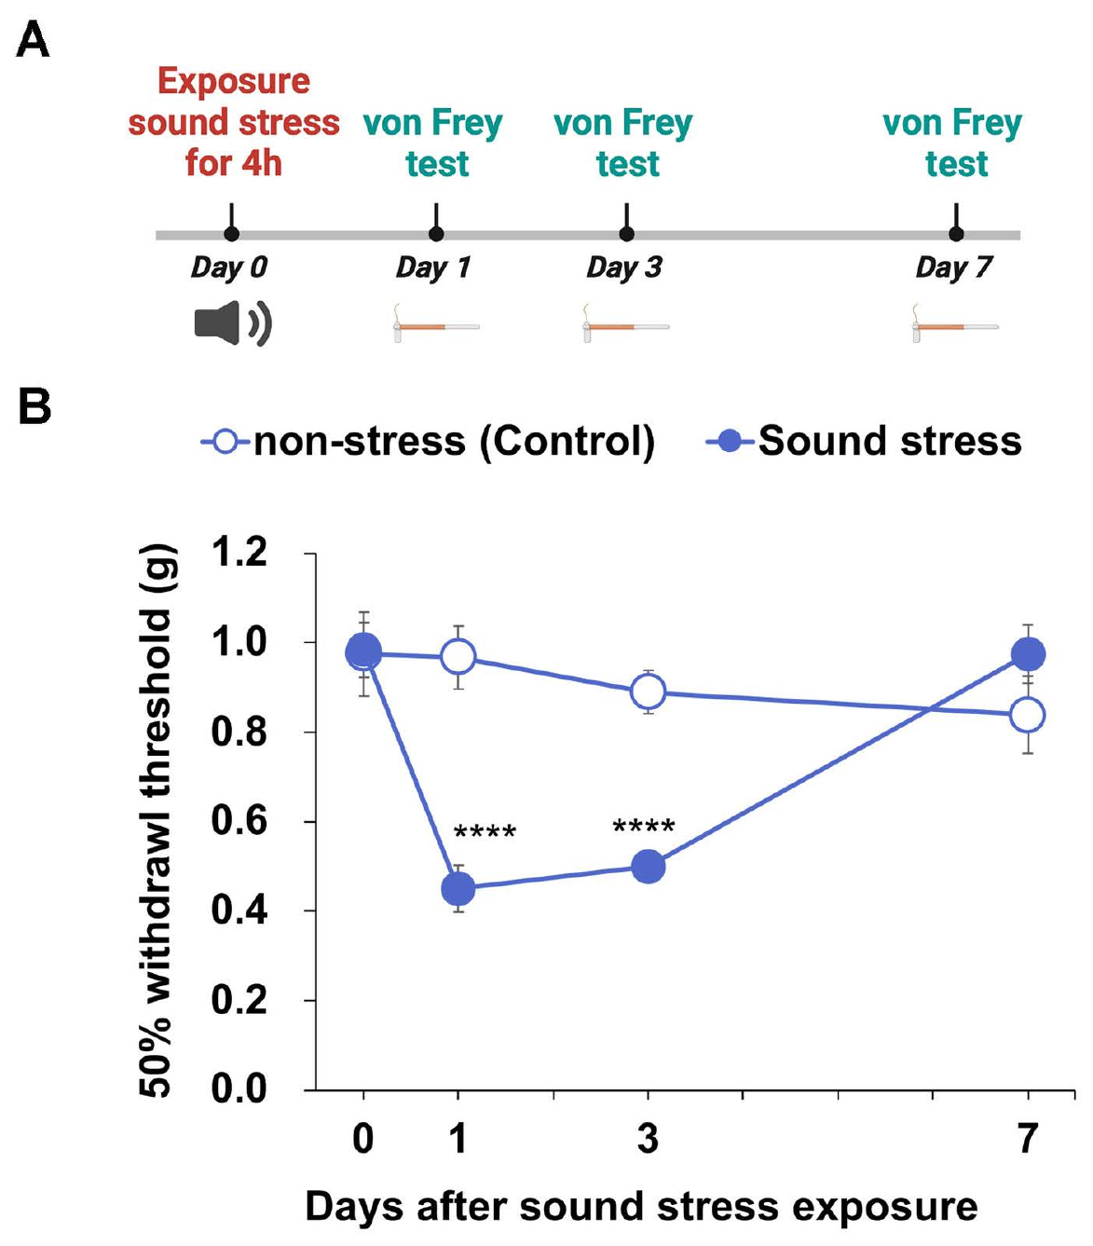
Pain-related ultrasound can alter later mechanical response
Kasai and colleagues recorded vocalizations during a noxious tail-pinching procedure. They retained frequencies above 20 kHz for playback to different, untreated mice. Ultrasound is sound above the approximate upper frequency limit of human hearing. Recipients heard the recording at 80 dB for 4 h. The preparation tested whether acoustic exposure could change later mechanical responsiveness without direct social contact.
Mechanical withdrawal thresholds were reduced on the days following playback. Thresholds approached control values again by day 7. The playback recipients had not received the original tail stimulus. Their own response to a calibrated filament changed after hearing the recording. This outcome differs from immediate freezing or orienting to sound because sensitivity was tested afterward.
The experiment describes a prolonged acoustic-stress exposure, not an isolated natural social call. That exposure duration matters when comparing it with a brief social encounter. In the Nakamura footage paradigm, removing sound did not reduce freezing under the tested visual and urine conditions. Acoustic contributions therefore depend on the preparation and measured response. One sensory modality can be effective in one context without being necessary in every form of social state matching.
Geng et al. (2026), Fig. 1A. The mouse social-interaction preparation.
Kasai et al. (2025), Fig. 2A–B. Mechanical thresholds after exposure to recorded ultrasound.
Kasai et al. (2025)
15
Notes:
• Kasai and colleagues recorded vocalizations during a noxious tail-pinching procedure. They retained frequencies above 20 kHz for playback to different, untreated mice. **Ultrasound** is sound above the approximate upper frequency limit of human hearing. Recipients heard the recording at 80 dB for 4 h. The preparation tested whether acoustic exposure could change later mechanical responsiveness without direct social contact.
• Mechanical withdrawal thresholds were reduced on the days following playback. Thresholds approached control values again by day 7. The playback recipients had not received the original tail stimulus. Their own response to a calibrated filament changed after hearing the recording. This outcome differs from immediate freezing or orienting to sound because sensitivity was tested afterward.
• The experiment describes a prolonged acoustic-stress exposure, not an isolated natural social call. That exposure duration matters when comparing it with a brief social encounter. In the Nakamura footage paradigm, removing sound did not reduce freezing under the tested visual and urine conditions. Acoustic contributions therefore depend on the preparation and measured response. One sensory modality can be effective in one context without being necessary in every form of social state matching.
References:
Kasai S, Ukai S, Kuroda J, Yamauchi T, Yamada D, Saitoh A, Iriyama S, Suzuki M, Arita K, Nakano Y, Miyazaki S, Yoshizawa K. (2025). Pain-stimulated ultrasound vocalizations and their impact on pain response in mice. PloS one 20(7):e0324730. https://doi.org/10.1371/journal.pone.0324730
Geng KW, Wang RR, Yang Y, Wang Y, He T, Li CL, Xu CS, Chen J. (2026). Hypothalamic-amygdala gating of caregiving-like prosocial behavior in mice. The Journal of clinical investigation 136(19):e204317. https://doi.org/10.1172/jci204317
Figure: Kasai et al. (2025), Fig. 2A–B. Mechanical thresholds after exposure to recorded ultrasound.
Figure source: https://doi.org/10.1371/journal.pone.0324730
Figure: Geng et al. (2026), Fig. 1A. The mouse social-interaction preparation.
Figure source: https://doi.org/10.1172/jci204317

Slide 16
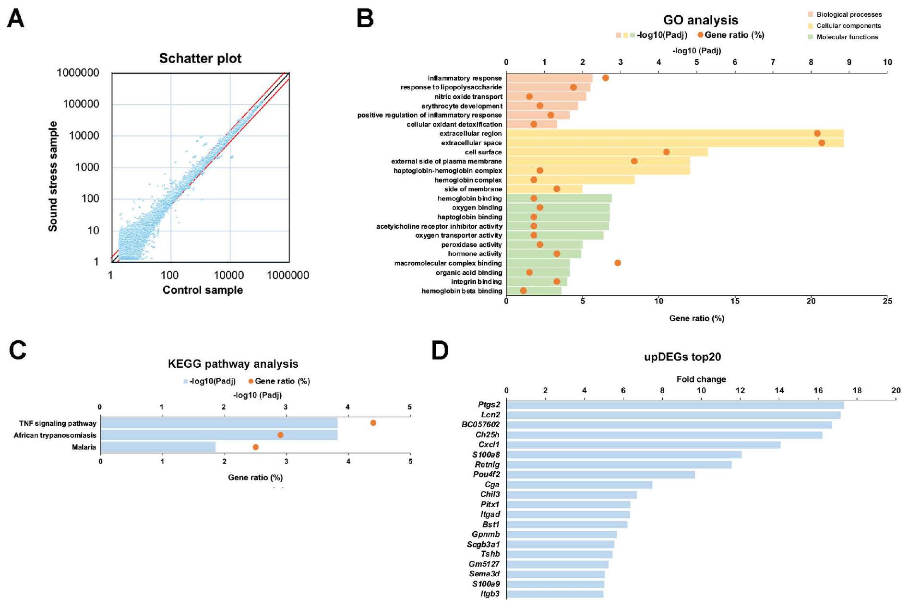
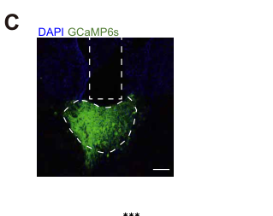
Acoustic exposure recruits thalamic inflammatory signaling
The acoustic-exposure study examined the thalamus, a forebrain structure involved in sensory processing. Investigators compared its gene expression after recorded sound stress with untreated controls. Several inflammation-related genes were elevated in the exposed group. The analysis included chemokine and immune-response pathways. These molecular changes accompanied the later reduction in mechanical withdrawal threshold.
A chemokine is a signaling protein that regulates cellular responses, including immune-cell communication. The researchers tested SB225002, an antagonist of the chemokine receptor CXCR2. An antagonist blocks activation of a receptor by its signaling molecule. This treatment reduced the increased responsiveness to a 0.4-g filament after sound exposure. The pharmacological result connects receptor signaling with the behavioral phenotype rather than expression measurements alone.
Loxoprofen, an anti-inflammatory analgesic, also reduced the measured response in the tested condition. The drug comparison addressed sensitivity after playback rather than altering the original recording. The source animals and recipients remained separate. Acoustic information can therefore initiate an adaptation involving both neural tissue and inflammatory signaling. The study connects a social-source stimulus with molecular changes and the recipient’s own later behavior.
Zhang et al. (2025), Fig. 2C. The paraventricular thalamic population, an anatomical comparison.
Kasai et al. (2025), Fig. 3A–D. Thalamic gene-expression changes following recorded sound stress.
Kasai et al. (2025)
16
Notes:
• The acoustic-exposure study examined the **thalamus**, a forebrain structure involved in sensory processing. Investigators compared its gene expression after recorded sound stress with untreated controls. Several inflammation-related genes were elevated in the exposed group. The analysis included chemokine and immune-response pathways. These molecular changes accompanied the later reduction in mechanical withdrawal threshold.
• A **chemokine** is a signaling protein that regulates cellular responses, including immune-cell communication. The researchers tested SB225002, an antagonist of the chemokine receptor CXCR2. An **antagonist** blocks activation of a receptor by its signaling molecule. This treatment reduced the increased responsiveness to a 0.4-g filament after sound exposure. The pharmacological result connects receptor signaling with the behavioral phenotype rather than expression measurements alone.
• Loxoprofen, an anti-inflammatory analgesic, also reduced the measured response in the tested condition. The drug comparison addressed sensitivity after playback rather than altering the original recording. The source animals and recipients remained separate. Acoustic information can therefore initiate an adaptation involving both neural tissue and inflammatory signaling. The study connects a social-source stimulus with molecular changes and the recipient’s own later behavior.
References:
Kasai S, Ukai S, Kuroda J, Yamauchi T, Yamada D, Saitoh A, Iriyama S, Suzuki M, Arita K, Nakano Y, Miyazaki S, Yoshizawa K. (2025). Pain-stimulated ultrasound vocalizations and their impact on pain response in mice. PloS one 20(7):e0324730. https://doi.org/10.1371/journal.pone.0324730
Zhang Z, Gong Y, Su XY, Su XY, Deng Y, Du R, Li CL, Wang Y, Song XL, Jiang Q, Li Y, Jian Y, Tong X, Wang GH, Chen J, Xu TL, Liu MG, Jiang F. (2025). Dysfunction of the paraventricular thalamus-prelimbic cortex circuit underlies maternal separation-induced deficits in contagious pain. Science advances 11(41):eady1944. https://doi.org/10.1126/sciadv.ady1944
Figure: Kasai et al. (2025), Fig. 3A–D. Thalamic gene-expression changes following recorded sound stress.
Figure source: https://doi.org/10.1371/journal.pone.0324730
Figure: Zhang et al. (2025), Fig. 2C. The paraventricular thalamic population, an anatomical comparison.
Figure source: https://doi.org/10.1126/sciadv.ady1944

Slide 17
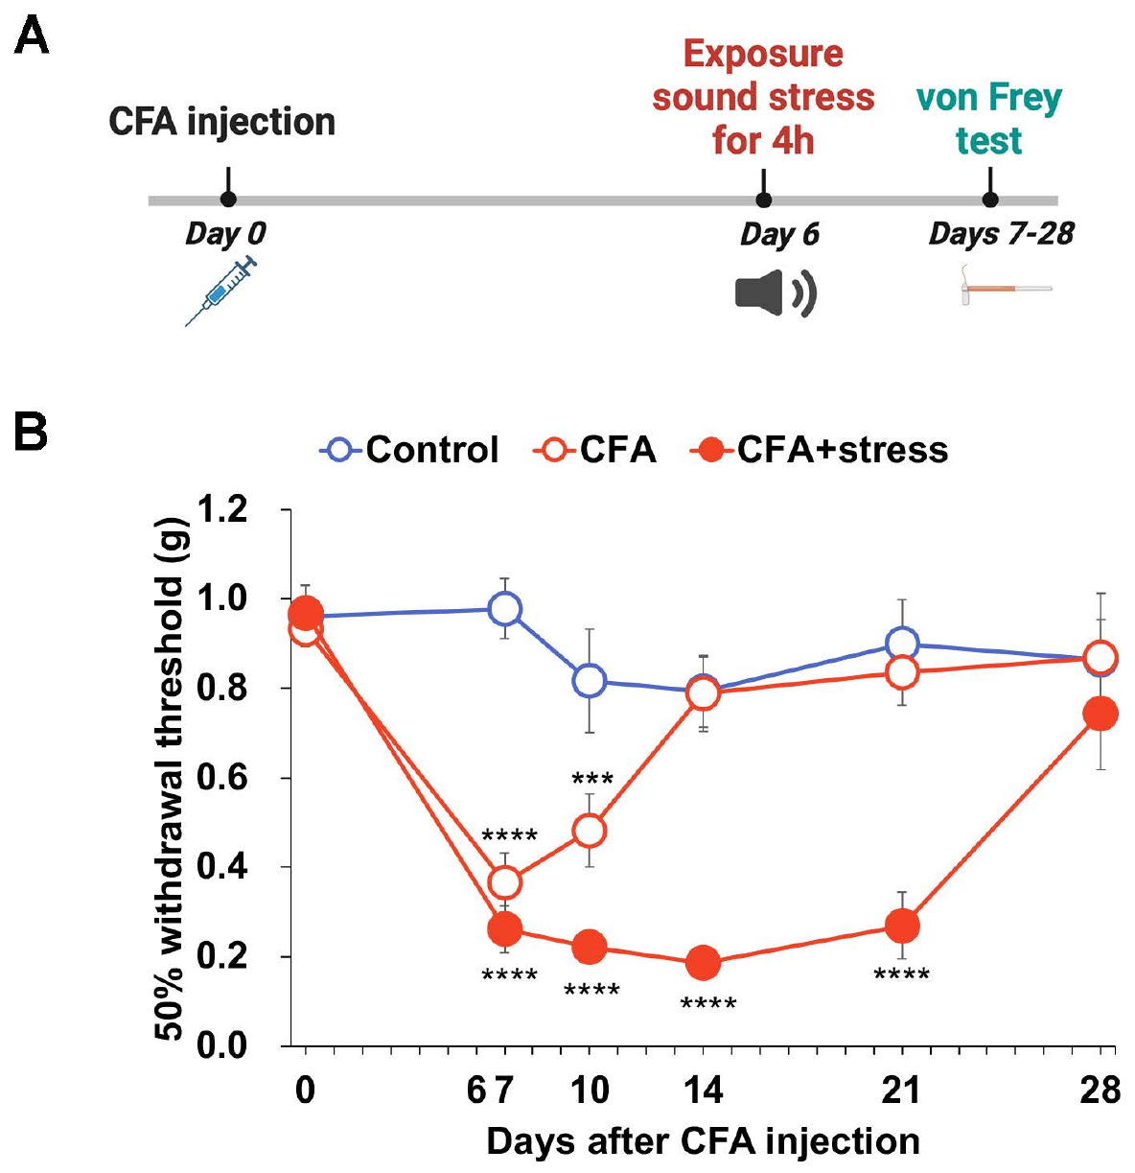
Sound exposure prolongs inflammatory hypersensitivity
The investigators combined the acoustic manipulation with a CFA inflammatory preparation. CFA was injected before the animals received the sound exposure. Mechanical thresholds were then followed repeatedly over several weeks. Control groups separated the inflammatory treatment from the additional acoustic condition. This design examined how a social-source signal changes an already sensitized recipient rather than initiating sensitivity in an untreated animal.
CFA alone reduced mechanical thresholds during the early testing interval. The CFA-plus-sound group retained lower thresholds through day 21. Thus the acoustic exposure prolonged the measured inflammatory hypersensitivity. The difference persisted after the 4-h playback had ended. A social sensory environment can alter the recovery trajectory of a recipient with an existing peripheral inflammatory condition.
The study also compared analgesic responses in the combined preparation. CXCR2 antagonism reduced filament responsiveness after the added sound exposure. Loxoprofen’s effect was weaker in the sound-exposed CFA condition than in CFA alone. Environmental history therefore changed both the time course and pharmacological response of the phenotype. Pain sensitivity reflects an interaction between the recipient’s injury state and subsequent sensory experience.
Geng et al. (2026), Fig. 1A. The mouse social-interaction preparation.
Kasai et al. (2025), Fig. 6A–B. CFA-associated threshold changes with and without sound exposure.
Kasai et al. (2025)
17
Notes:
• The investigators combined the acoustic manipulation with a CFA inflammatory preparation. CFA was injected before the animals received the sound exposure. Mechanical thresholds were then followed repeatedly over several weeks. Control groups separated the inflammatory treatment from the additional acoustic condition. This design examined how a social-source signal changes an already sensitized recipient rather than initiating sensitivity in an untreated animal.
• CFA alone reduced mechanical thresholds during the early testing interval. The CFA-plus-sound group retained lower thresholds through day 21. Thus the acoustic exposure prolonged the measured inflammatory hypersensitivity. The difference persisted after the 4-h playback had ended. A social sensory environment can alter the recovery trajectory of a recipient with an existing peripheral inflammatory condition.
• The study also compared analgesic responses in the combined preparation. CXCR2 antagonism reduced filament responsiveness after the added sound exposure. Loxoprofen’s effect was weaker in the sound-exposed CFA condition than in CFA alone. Environmental history therefore changed both the time course and pharmacological response of the phenotype. Pain sensitivity reflects an interaction between the recipient’s injury state and subsequent sensory experience.
References:
Kasai S, Ukai S, Kuroda J, Yamauchi T, Yamada D, Saitoh A, Iriyama S, Suzuki M, Arita K, Nakano Y, Miyazaki S, Yoshizawa K. (2025). Pain-stimulated ultrasound vocalizations and their impact on pain response in mice. PloS one 20(7):e0324730. https://doi.org/10.1371/journal.pone.0324730
Geng KW, Wang RR, Yang Y, Wang Y, He T, Li CL, Xu CS, Chen J. (2026). Hypothalamic-amygdala gating of caregiving-like prosocial behavior in mice. The Journal of clinical investigation 136(19):e204317. https://doi.org/10.1172/jci204317
Figure: Kasai et al. (2025), Fig. 6A–B. CFA-associated threshold changes with and without sound exposure.
Figure source: https://doi.org/10.1371/journal.pone.0324730
Figure: Geng et al. (2026), Fig. 1A. The mouse social-interaction preparation.
Figure source: https://doi.org/10.1172/jci204317

Slide 18
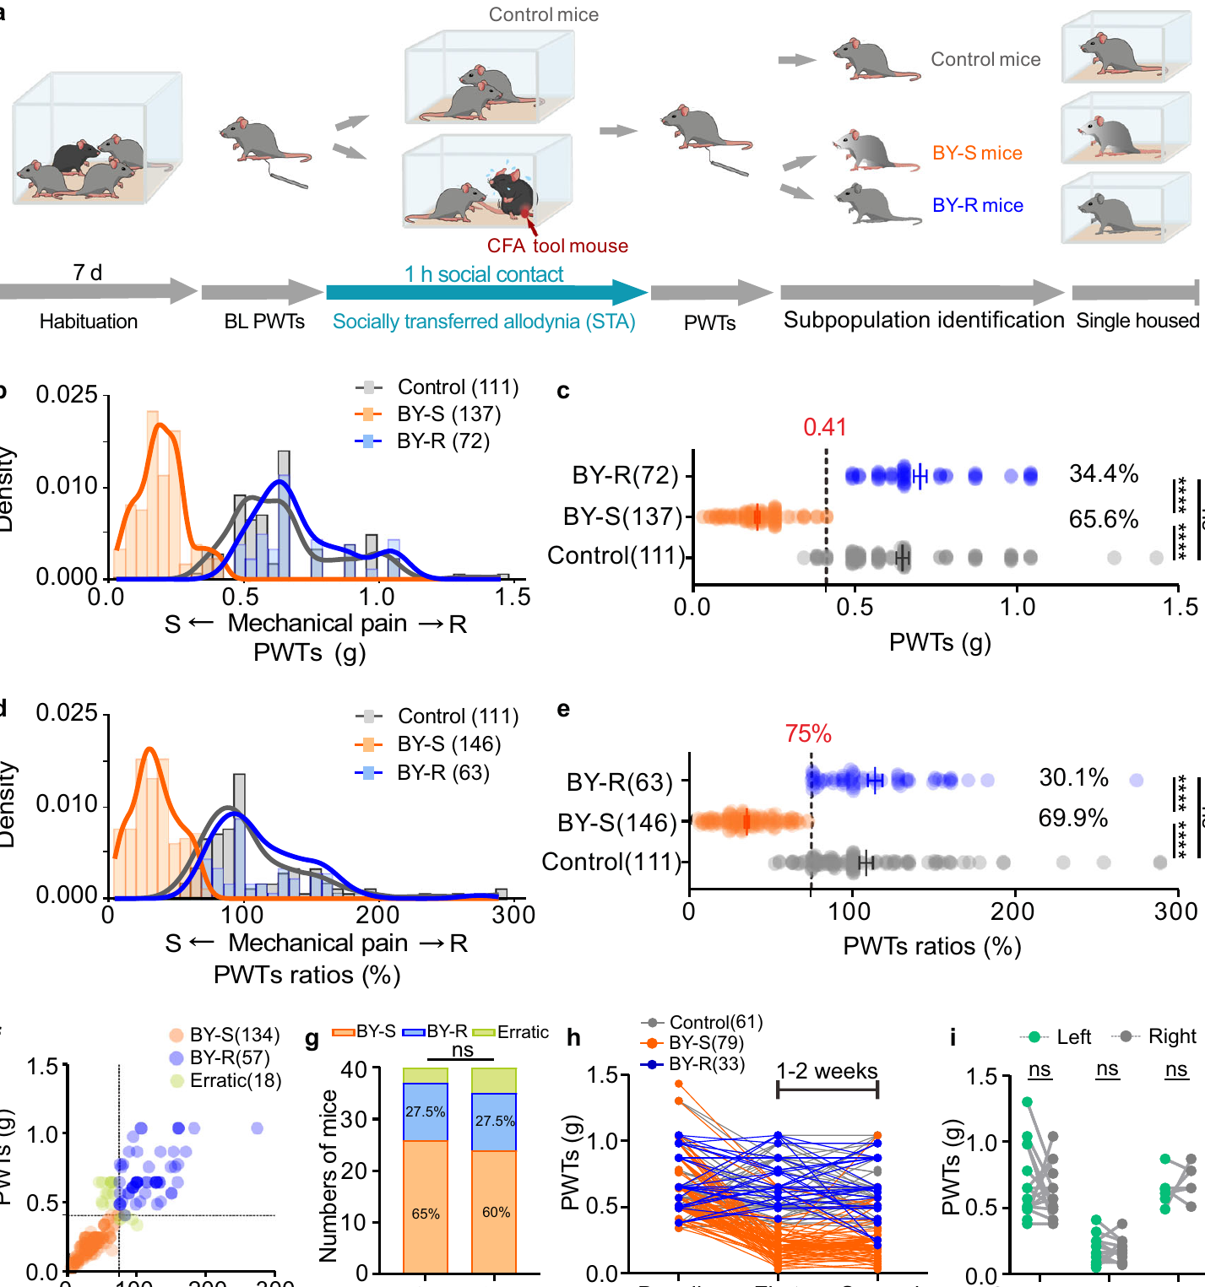
Social exposure yields susceptible and resilient mice
Han and colleagues paired male mice with familiar CFA-treated partners for 1 h. The untreated bystanders were tested with calibrated mechanical filaments. Some developed markedly reduced thresholds, while others retained thresholds near baseline. Susceptibility here means developing the measured socially transferred allodynia. Resilience means retaining the comparatively normal threshold despite exposure to the same experimental social condition.
Allodynia is a response to stimulation ordinarily below the noxious range. The investigators classified bystanders using their measured paw withdrawal thresholds. They also compared thresholds as a proportion of each animal’s baseline. Both approaches identified susceptible and resilient subgroups. The classification concerned the recipient’s behavioral outcome rather than whether it had encountered an affected partner.
Repeated social-transfer tests helped assess the stability of these individual differences. Many bystanders retained their susceptible or resilient pattern across separated encounters. Both hind paws were examined to characterize the response beyond one local skin region. This variation motivated a search for neural activity associated with resilience. Social input does not produce an identical sensitivity change in every recipient of the same species and sex.
Geng et al. (2026), Fig. 1A. The mouse social-interaction preparation.
Han et al. (2024), Fig. 1b–i. Individual mechanical thresholds and repeated social-transfer outcomes.
Han et al. (2024)
18
Notes:
• Han and colleagues paired male mice with familiar CFA-treated partners for 1 h. The untreated bystanders were tested with calibrated mechanical filaments. Some developed markedly reduced thresholds, while others retained thresholds near baseline. **Susceptibility** here means developing the measured socially transferred allodynia. **Resilience** means retaining the comparatively normal threshold despite exposure to the same experimental social condition.
• **Allodynia** is a response to stimulation ordinarily below the noxious range. The investigators classified bystanders using their measured paw withdrawal thresholds. They also compared thresholds as a proportion of each animal’s baseline. Both approaches identified susceptible and resilient subgroups. The classification concerned the recipient’s behavioral outcome rather than whether it had encountered an affected partner.
• Repeated social-transfer tests helped assess the stability of these individual differences. Many bystanders retained their susceptible or resilient pattern across separated encounters. Both hind paws were examined to characterize the response beyond one local skin region. This variation motivated a search for neural activity associated with resilience. Social input does not produce an identical sensitivity change in every recipient of the same species and sex.
References:
Han Y, Ai L, Song L, Zhou Y, Chen D, Sha S, Ji R, Li Q, Bu Q, Pan X, Zhai X, Cui M, Duan J, Yang J, Chaudhury D, Hu A, Liu H, Han MH, Cao JL, Zhang H. (2024). Midbrain glutamatergic circuit mechanism of resilience to socially transferred allodynia in male mice. Nature communications 15(1):4947. https://doi.org/10.1038/s41467-024-49340-8
Geng KW, Wang RR, Yang Y, Wang Y, He T, Li CL, Xu CS, Chen J. (2026). Hypothalamic-amygdala gating of caregiving-like prosocial behavior in mice. The Journal of clinical investigation 136(19):e204317. https://doi.org/10.1172/jci204317
Figure: Han et al. (2024), Fig. 1b–i. Individual mechanical thresholds and repeated social-transfer outcomes.
Figure source: https://doi.org/10.1038/s41467-024-49340-8
Figure: Geng et al. (2026), Fig. 1A. The mouse social-interaction preparation.
Figure source: https://doi.org/10.1172/jci204317

Slide 19
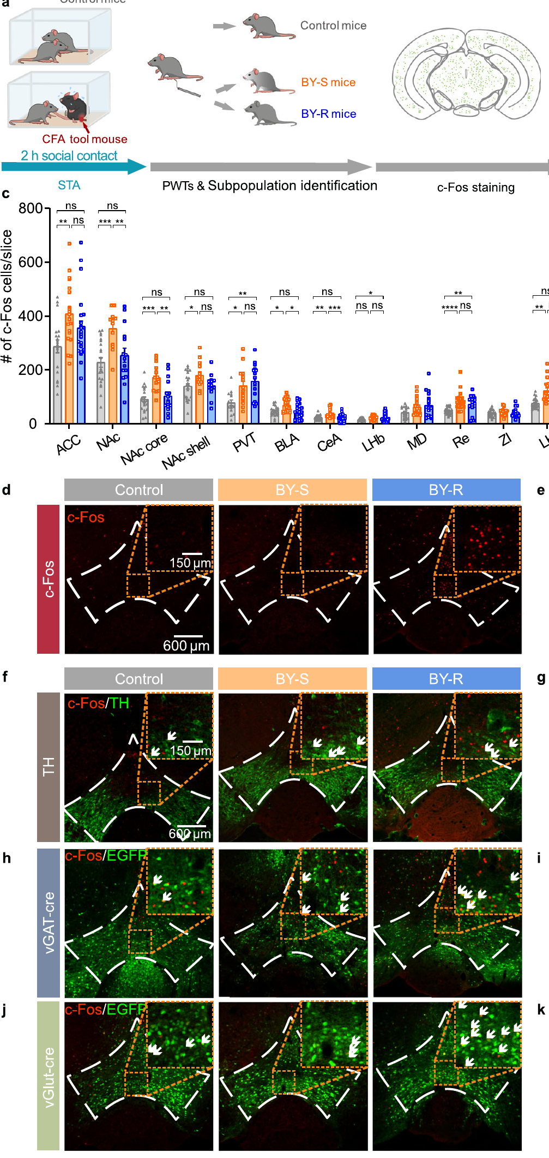
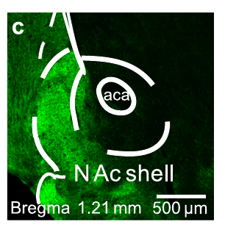
Resilience recruits VTA glutamatergic neurons
The ventral tegmental area, or VTA, is a midbrain region containing several transmitter-defined neuronal populations. Researchers screened brain regions for activity-associated c-Fos expression after the social-transfer assay. c-Fos is a protein used to mark recently activated cells. Resilient bystanders showed increased VTA labeling compared with susceptible and control animals. The investigators then determined which neuronal classes accounted for that difference.
The selective increase occurred in glutamatergic neurons, cells that release glutamate. Comparable activation was not identified in the tested dopamine or GABA populations. VGLUT2 is a vesicular transporter used to identify the relevant glutamate-releasing neurons. Fluorescent labeling distinguished transmitter identity from recent activity in the same region. Thus the VTA finding was more specific than a general increase in all midbrain activity.
Electrical recordings also examined the identified VTA neurons. The resilience-associated population showed altered firing after social exposure. Action potentials are the brief electrical events through which neurons communicate along axons. Combining cellular identity, activity labeling, and recording connected resilience with a defined neuronal population. Subsequent manipulations tested whether changing this population could alter the recipient’s pain-transfer outcome.
Han et al. (2024), Fig. 5c. Labeled VTA axons in the accumbens shell.
Han et al. (2024), Fig. 2d–k. VTA activity labeling across neuronal transmitter classes.
Han et al. (2024)
19
Notes:
• The **ventral tegmental area**, or VTA, is a midbrain region containing several transmitter-defined neuronal populations. Researchers screened brain regions for activity-associated c-Fos expression after the social-transfer assay. **c-Fos** is a protein used to mark recently activated cells. Resilient bystanders showed increased VTA labeling compared with susceptible and control animals. The investigators then determined which neuronal classes accounted for that difference.
• The selective increase occurred in **glutamatergic neurons**, cells that release glutamate. Comparable activation was not identified in the tested dopamine or GABA populations. **VGLUT2** is a vesicular transporter used to identify the relevant glutamate-releasing neurons. Fluorescent labeling distinguished transmitter identity from recent activity in the same region. Thus the VTA finding was more specific than a general increase in all midbrain activity.
• Electrical recordings also examined the identified VTA neurons. The resilience-associated population showed altered firing after social exposure. **Action potentials** are the brief electrical events through which neurons communicate along axons. Combining cellular identity, activity labeling, and recording connected resilience with a defined neuronal population. Subsequent manipulations tested whether changing this population could alter the recipient’s pain-transfer outcome.
References:
Han Y, Ai L, Song L, Zhou Y, Chen D, Sha S, Ji R, Li Q, Bu Q, Pan X, Zhai X, Cui M, Duan J, Yang J, Chaudhury D, Hu A, Liu H, Han MH, Cao JL, Zhang H. (2024). Midbrain glutamatergic circuit mechanism of resilience to socially transferred allodynia in male mice. Nature communications 15(1):4947. https://doi.org/10.1038/s41467-024-49340-8
Figure: Han et al. (2024), Fig. 2d–k. VTA activity labeling across neuronal transmitter classes.
Figure source: https://doi.org/10.1038/s41467-024-49340-8
Figure: Han et al. (2024), Fig. 5c. Labeled VTA axons in the accumbens shell.
Figure source: https://doi.org/10.1038/s41467-024-49340-8

Slide 20
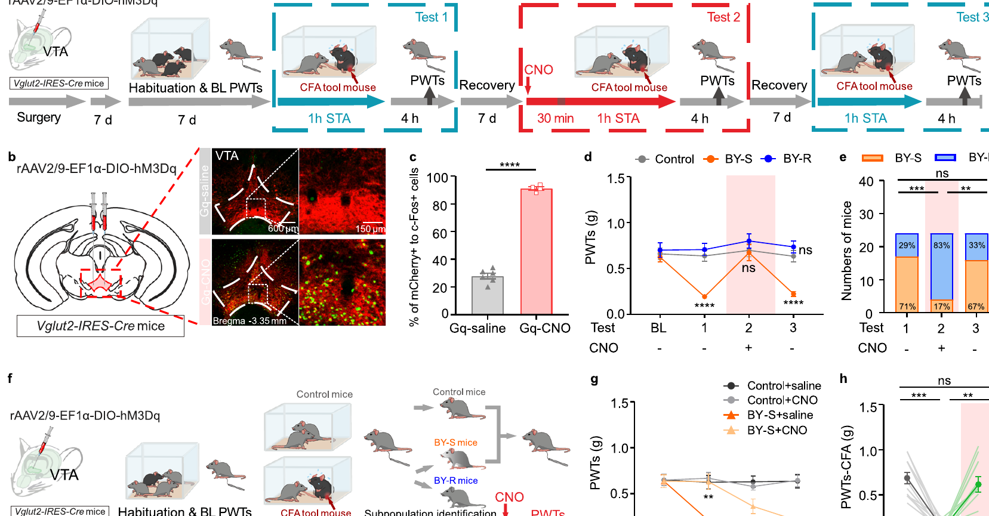
Activating VTA glutamate neurons promotes resilience
Chemogenetics changes neuronal activity using an engineered receptor activated by an administered ligand. The researchers expressed the excitatory receptor hM3Dq in VTA glutamatergic neurons. Receptor activation increased activity in the targeted population. The social-transfer assay was repeated under control and activation conditions. This manipulation tested causality rather than relying on the association between c-Fos labeling and resilience.
Activating these neurons shifted susceptible bystanders toward a resilient threshold pattern. Repeated testing allowed the effect to be compared within the same experimental sequence. Activation after social contact also temporarily raised thresholds in susceptible mice. The response was measured at defined post-treatment intervals, including 30 min. The neuronal population therefore influences both acquisition and short-term expression of socially transferred sensitivity.
The same manipulation did not comparably reverse the CFA demonstrator’s primary inflammatory hypersensitivity. That control separates the social-transfer phenotype from a general analgesic effect in every treated animal. The recipient’s circuit can oppose socially acquired sensitivity. It need not remove the partner’s peripheral inflammatory condition. Midbrain activity can consequently modulate how social information affects the bystander’s own mechanical response.
Han et al. (2024), Fig. 3b–h. Chemogenetic activation and mechanical-threshold outcomes.
Han et al. (2024), Fig. 5c. Labeled VTA axons in the accumbens shell.
Han et al. (2024)
20
Notes:
• **Chemogenetics** changes neuronal activity using an engineered receptor activated by an administered ligand. The researchers expressed the excitatory receptor hM3Dq in VTA glutamatergic neurons. Receptor activation increased activity in the targeted population. The social-transfer assay was repeated under control and activation conditions. This manipulation tested causality rather than relying on the association between c-Fos labeling and resilience.
• Activating these neurons shifted susceptible bystanders toward a resilient threshold pattern. Repeated testing allowed the effect to be compared within the same experimental sequence. Activation after social contact also temporarily raised thresholds in susceptible mice. The response was measured at defined post-treatment intervals, including 30 min. The neuronal population therefore influences both acquisition and short-term expression of socially transferred sensitivity.
• The same manipulation did not comparably reverse the CFA demonstrator’s primary inflammatory hypersensitivity. That control separates the social-transfer phenotype from a general analgesic effect in every treated animal. The recipient’s circuit can oppose socially acquired sensitivity. It need not remove the partner’s peripheral inflammatory condition. Midbrain activity can consequently modulate how social information affects the bystander’s own mechanical response.
References:
Han Y, Ai L, Song L, Zhou Y, Chen D, Sha S, Ji R, Li Q, Bu Q, Pan X, Zhai X, Cui M, Duan J, Yang J, Chaudhury D, Hu A, Liu H, Han MH, Cao JL, Zhang H. (2024). Midbrain glutamatergic circuit mechanism of resilience to socially transferred allodynia in male mice. Nature communications 15(1):4947. https://doi.org/10.1038/s41467-024-49340-8
Figure: Han et al. (2024), Fig. 3b–h. Chemogenetic activation and mechanical-threshold outcomes.
Figure source: https://doi.org/10.1038/s41467-024-49340-8
Figure: Han et al. (2024), Fig. 5c. Labeled VTA axons in the accumbens shell.
Figure source: https://doi.org/10.1038/s41467-024-49340-8

Slide 21
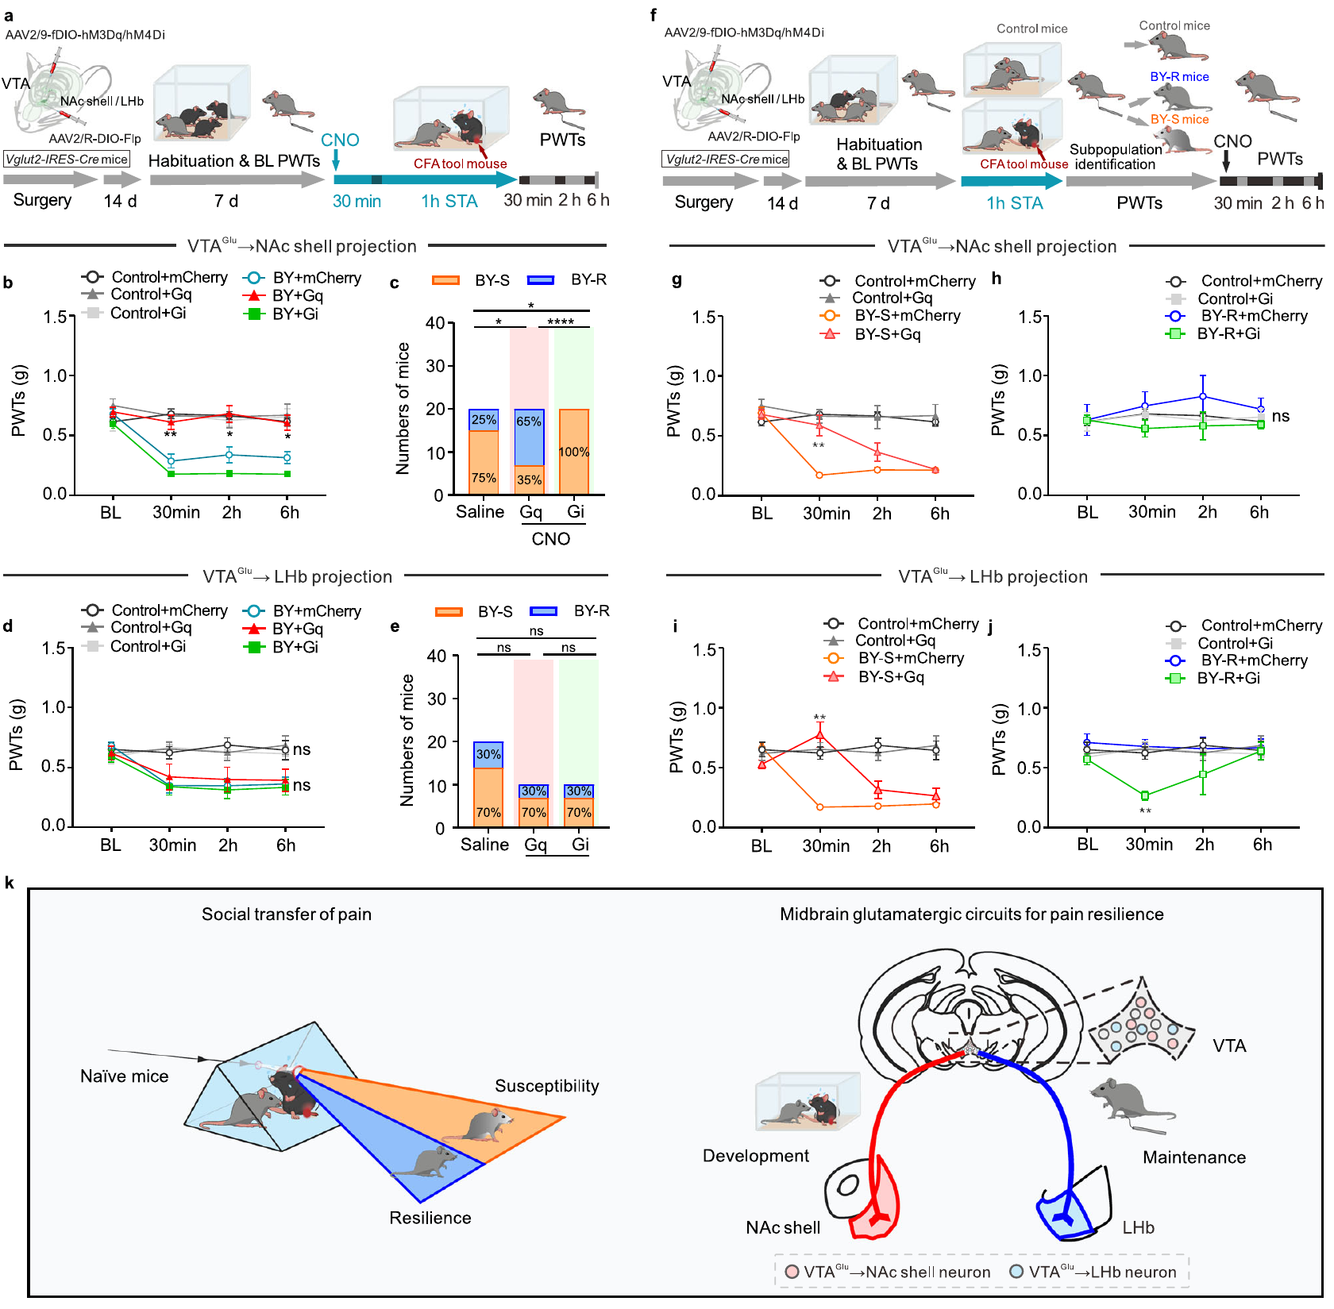
VTA output targets separate resilience functions
The VTA glutamatergic neurons projected to the nucleus accumbens shell and lateral habenula. A projection is an axonal pathway connecting one neuronal population with another region. The nucleus accumbens shell is a ventral striatal region involved in motivational regulation. The lateral habenula is an epithalamic structure participating in aversive-state processing. Anatomical tracing identified largely distinct VTA populations supplying these two targets.
The investigators manipulated each projection-defined population separately. The accumbens-shell pathway influenced the development of resilience during social exposure. The habenula-directed population influenced its maintenance after exposure. Testing both targets at different times separated circuit function from a simple list of connected regions. The timing of the intervention was therefore part of the mechanistic result.
Electrical recordings characterized glutamatergic input to the target neurons. Light activation of labeled axons elicited excitatory postsynaptic currents. Postsynaptic currents are electrical responses in a neuron receiving synaptic input. Blocking AMPA receptors, glutamate-gated cation channels, suppressed that excitation. This connects a transmitter-specific anatomical pathway with synaptic excitation and the recipient’s subsequent mechanical sensitivity.
Han et al. (2024), Fig. 5c. Labeled VTA axons in the accumbens shell.
Han et al. (2024), Fig. 6a–j. Projection-specific manipulations during and after social transfer.
Han et al. (2024)
21
Notes:
• The VTA glutamatergic neurons projected to the nucleus accumbens shell and lateral habenula. A **projection** is an axonal pathway connecting one neuronal population with another region. The **nucleus accumbens shell** is a ventral striatal region involved in motivational regulation. The **lateral habenula** is an epithalamic structure participating in aversive-state processing. Anatomical tracing identified largely distinct VTA populations supplying these two targets.
• The investigators manipulated each projection-defined population separately. The accumbens-shell pathway influenced the development of resilience during social exposure. The habenula-directed population influenced its maintenance after exposure. Testing both targets at different times separated circuit function from a simple list of connected regions. The timing of the intervention was therefore part of the mechanistic result.
• Electrical recordings characterized glutamatergic input to the target neurons. Light activation of labeled axons elicited excitatory postsynaptic currents. **Postsynaptic currents** are electrical responses in a neuron receiving synaptic input. Blocking **AMPA receptors**, glutamate-gated cation channels, suppressed that excitation. This connects a transmitter-specific anatomical pathway with synaptic excitation and the recipient’s subsequent mechanical sensitivity.
References:
Han Y, Ai L, Song L, Zhou Y, Chen D, Sha S, Ji R, Li Q, Bu Q, Pan X, Zhai X, Cui M, Duan J, Yang J, Chaudhury D, Hu A, Liu H, Han MH, Cao JL, Zhang H. (2024). Midbrain glutamatergic circuit mechanism of resilience to socially transferred allodynia in male mice. Nature communications 15(1):4947. https://doi.org/10.1038/s41467-024-49340-8
Figure: Han et al. (2024), Fig. 6a–j. Projection-specific manipulations during and after social transfer.
Figure source: https://doi.org/10.1038/s41467-024-49340-8
Figure: Han et al. (2024), Fig. 5c. Labeled VTA axons in the accumbens shell.
Figure source: https://doi.org/10.1038/s41467-024-49340-8

Slide 22
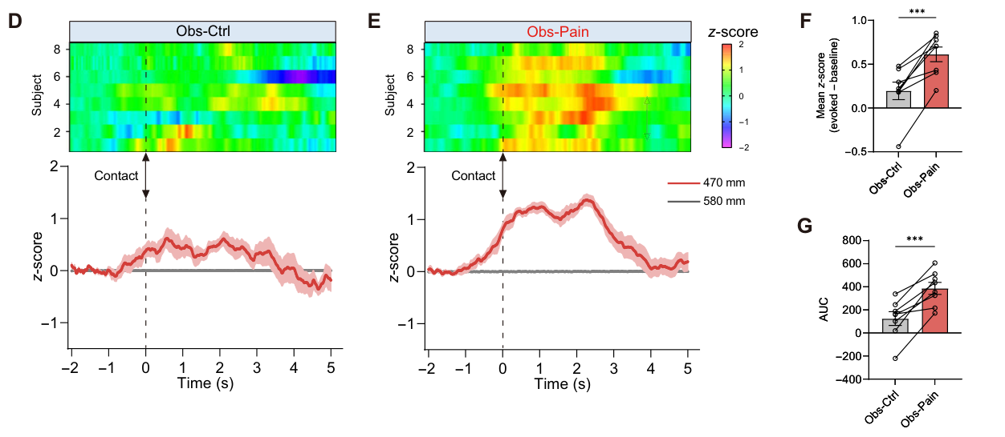
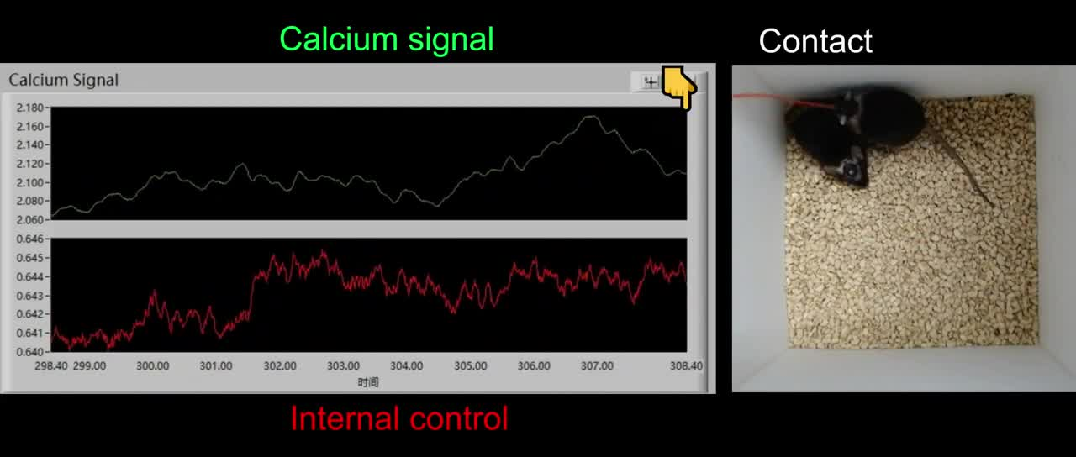
Body contact recruits paraventricular thalamic activity
Zhang and colleagues examined the paraventricular thalamus, or PVT, during social pain contagion. Familiar observer mice interacted with a neutral demonstrator and then a venom-treated demonstrator. The researchers expressed GCaMP6s in excitatory PVT neurons. GCaMP6s is a fluorescent sensor whose signal increases with intracellular calcium. Fiber photometry recorded this population signal while the mice moved and contacted one another.
Fiber photometry measures fluorescent activity through an implanted optical fiber. The investigators aligned the recorded signal with the onset of observer body contact. Contact with the painful demonstrator produced a stronger PVT calcium response than contact with the neutral condition. Movie S1 preserves the simultaneous social behavior and population recording. The timing connects neuronal recruitment with a particular component of the encounter.
The behavioral assay followed the observer’s mechanical threshold after interaction. Inhibiting PVT neurons reduced the socially induced threshold decrease. The same intervention impaired discrimination in a separate partner-exploration task. This links PVT activity to both social-state processing and the recipient’s own later responsiveness. Contact-related activity therefore belongs to a circuit with a causal behavioral contribution, rather than being a recording correlate alone.
Zhang et al. (2025), Fig. 2D–G. Contact-aligned PVT calcium signals during social interaction.
Zhang et al. (2025), Fig. 2C. The targeted PVT neuronal population.
Zhang et al. (2025), Movie S1. Standard-reared observer PVT contact-related calcium activity.
Zhang et al. (2025)
22
Notes:
• Zhang and colleagues examined the **paraventricular thalamus**, or PVT, during social pain contagion. Familiar observer mice interacted with a neutral demonstrator and then a venom-treated demonstrator. The researchers expressed GCaMP6s in excitatory PVT neurons. **GCaMP6s** is a fluorescent sensor whose signal increases with intracellular calcium. Fiber photometry recorded this population signal while the mice moved and contacted one another.
• **Fiber photometry** measures fluorescent activity through an implanted optical fiber. The investigators aligned the recorded signal with the onset of observer body contact. Contact with the painful demonstrator produced a stronger PVT calcium response than contact with the neutral condition. Movie S1 preserves the simultaneous social behavior and population recording. The timing connects neuronal recruitment with a particular component of the encounter.
• The behavioral assay followed the observer’s mechanical threshold after interaction. Inhibiting PVT neurons reduced the socially induced threshold decrease. The same intervention impaired discrimination in a separate partner-exploration task. This links PVT activity to both social-state processing and the recipient’s own later responsiveness. Contact-related activity therefore belongs to a circuit with a causal behavioral contribution, rather than being a recording correlate alone.
References:
Zhang Z, Gong Y, Su XY, Su XY, Deng Y, Du R, Li CL, Wang Y, Song XL, Jiang Q, Li Y, Jian Y, Tong X, Wang GH, Chen J, Xu TL, Liu MG, Jiang F. (2025). Dysfunction of the paraventricular thalamus-prelimbic cortex circuit underlies maternal separation-induced deficits in contagious pain. Science advances 11(41):eady1944. https://doi.org/10.1126/sciadv.ady1944
Figure: Zhang et al. (2025), Fig. 2D–G. Contact-aligned PVT calcium signals during social interaction.
Figure source: https://doi.org/10.1126/sciadv.ady1944
Figure: Zhang et al. (2025), Fig. 2C. The targeted PVT neuronal population.
Figure source: https://doi.org/10.1126/sciadv.ady1944
Embedded video: Zhang et al. (2025), Movie S1. Standard-reared observer PVT contact-related calcium activity.
Exact source identifier: Movie S1
Article DOI: https://doi.org/10.1126/sciadv.ady1944
Original media URL: https://pmc-oa-opendata.s3.amazonaws.com/PMC12506963.1/sciadv.ady1944_movies_s1_to_s4.zip
Credit: Zhang Z, Gong Y, Su XY, Su XY, Deng Y, Du R, Li CL, Wang Y, Song XL, Jiang Q, Li Y, Jian Y, Tong X, Wang GH, Chen J, Xu TL, Liu MG, Jiang F. License: CC BY 4.0.
H.264/AAC compatibility conversion at original speed; original audio preserved; full recording retained. Poster is a source frame. Playback is full screen where the viewer supports it. Desktop PowerPoint GUI playback and Google Slides import remain untested. Google Slides may require separate Drive media insertion.

Slide 23
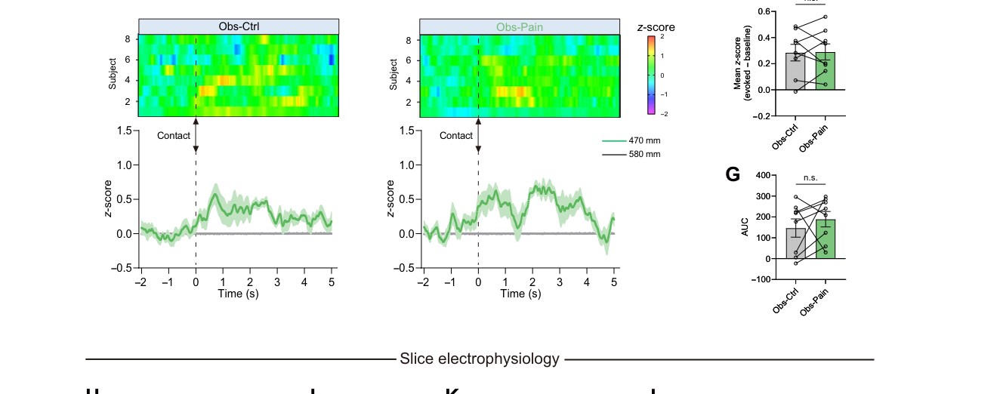
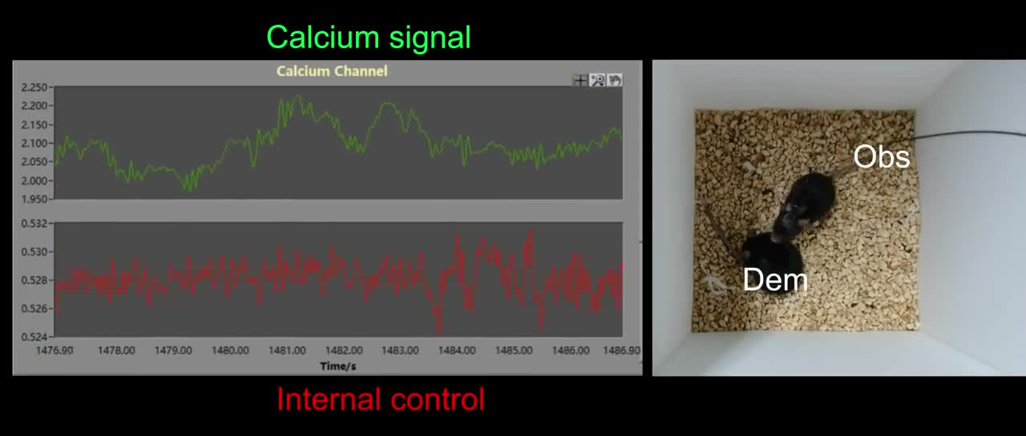
Early adversity dampens contact-related thalamic activity
Maternal separation is an early-life rearing manipulation that repeatedly removes pups from their mother. Standard-reared mice supplied the comparison group. In adulthood, both groups encountered familiar demonstrators in the same contagious-pain assay. The early-separated observers developed less contagious mechanical hypersensitivity. Their ability to distinguish neutral from painful demonstrators was also reduced.
Movie S2 records PVT population activity during the social encounters of early-separated observers. Contact with the painful demonstrator did not evoke the strong calcium increase found in standard-reared observers. Control and painful demonstrator encounters produced more similar population responses. The recording links early experience with altered processing during current contact. The social stimulus was present, but thalamic recruitment differed.
The researchers compared this population result with cellular electrical properties. Early separation reduced excitability in the identified PVT population. The resulting circuit could therefore respond differently to inputs available during the encounter. Developmental history changed both social discrimination and the subsequent threshold response. Reduced contagion here accompanied impaired social discrimination, rather than simply providing protection from distress.
Zhang et al. (2025), Fig. 3D–G. PVT calcium responses after maternal separation.
Zhang et al. (2025), Fig. 2C. The targeted PVT neuronal population.
Zhang et al. (2025), Movie S2. Maternal-separated observer PVT contact-related calcium activity.
Zhang et al. (2025)
23
Notes:
• **Maternal separation** is an early-life rearing manipulation that repeatedly removes pups from their mother. Standard-reared mice supplied the comparison group. In adulthood, both groups encountered familiar demonstrators in the same contagious-pain assay. The early-separated observers developed less contagious mechanical hypersensitivity. Their ability to distinguish neutral from painful demonstrators was also reduced.
• Movie S2 records PVT population activity during the social encounters of early-separated observers. Contact with the painful demonstrator did not evoke the strong calcium increase found in standard-reared observers. Control and painful demonstrator encounters produced more similar population responses. The recording links early experience with altered processing during current contact. The social stimulus was present, but thalamic recruitment differed.
• The researchers compared this population result with cellular electrical properties. Early separation reduced excitability in the identified PVT population. The resulting circuit could therefore respond differently to inputs available during the encounter. Developmental history changed both social discrimination and the subsequent threshold response. Reduced contagion here accompanied impaired social discrimination, rather than simply providing protection from distress.
References:
Zhang Z, Gong Y, Su XY, Su XY, Deng Y, Du R, Li CL, Wang Y, Song XL, Jiang Q, Li Y, Jian Y, Tong X, Wang GH, Chen J, Xu TL, Liu MG, Jiang F. (2025). Dysfunction of the paraventricular thalamus-prelimbic cortex circuit underlies maternal separation-induced deficits in contagious pain. Science advances 11(41):eady1944. https://doi.org/10.1126/sciadv.ady1944
Figure: Zhang et al. (2025), Fig. 3D–G. PVT calcium responses after maternal separation.
Figure source: https://doi.org/10.1126/sciadv.ady1944
Figure: Zhang et al. (2025), Fig. 2C. The targeted PVT neuronal population.
Figure source: https://doi.org/10.1126/sciadv.ady1944
Embedded video: Zhang et al. (2025), Movie S2. Maternal-separated observer PVT contact-related calcium activity.
Exact source identifier: Movie S2
Article DOI: https://doi.org/10.1126/sciadv.ady1944
Original media URL: https://pmc-oa-opendata.s3.amazonaws.com/PMC12506963.1/sciadv.ady1944_movies_s1_to_s4.zip
Credit: Zhang Z, Gong Y, Su XY, Su XY, Deng Y, Du R, Li CL, Wang Y, Song XL, Jiang Q, Li Y, Jian Y, Tong X, Wang GH, Chen J, Xu TL, Liu MG, Jiang F. License: CC BY 4.0.
H.264/AAC compatibility conversion at original speed; original audio preserved; full recording retained. Poster is a source frame. Playback is full screen where the viewer supports it. Desktop PowerPoint GUI playback and Google Slides import remain untested. Google Slides may require separate Drive media insertion.

Slide 24
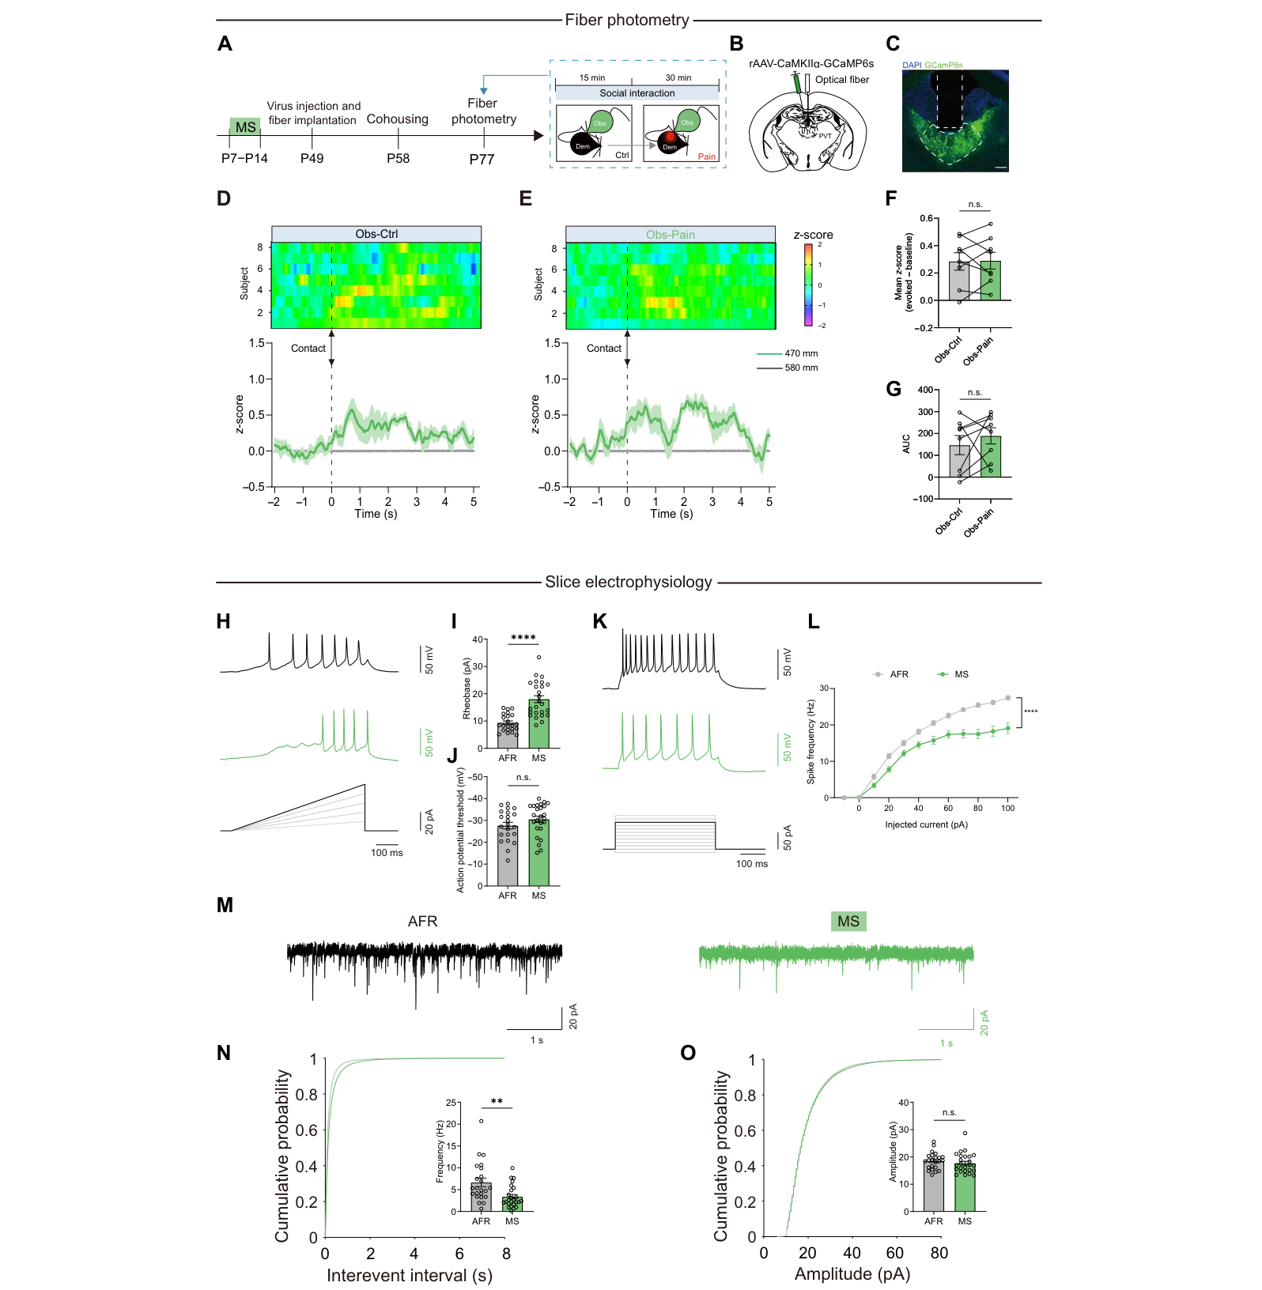
Early separation reduces PVT excitability and input
Whole-cell patch-clamp recording measures electrical activity through a pipette connected to a neuron’s interior. Researchers used this technique on PVT neurons in brain slices. They compared cells from standard-reared and early-separated mice. Depolarizing current was injected to assess how readily each neuron produced action potentials. The preparation separates intrinsic cellular responsiveness from the animal’s ongoing social movements.
Rheobase is the minimum applied current required to trigger an action potential under the tested protocol. Early-separated mice had PVT neurons requiring stronger excitation to fire. At the same injected current, the neurons produced fewer spikes. An 80-pA current step provided one of the direct trace comparisons. These measurements identify a cellular change capable of weakening recruitment during social exposure.
The investigators also recorded spontaneous excitatory postsynaptic currents. These currents reflect excitatory input arriving through synapses in the slice. Their frequency and amplitude were altered after early separation. Both input and intrinsic responsiveness therefore contributed to the affected neuronal state. The physiology gives a mechanistic link between developmental experience, reduced contact-associated calcium activity, and impaired contagious-pain behavior.
Zhang et al. (2025), Fig. 2C. The targeted PVT neuronal population.
Zhang et al. (2025), Fig. 3H–O. Action-potential responses and excitatory synaptic currents.
Zhang et al. (2025)
24
Notes:
• **Whole-cell patch-clamp recording** measures electrical activity through a pipette connected to a neuron’s interior. Researchers used this technique on PVT neurons in brain slices. They compared cells from standard-reared and early-separated mice. Depolarizing current was injected to assess how readily each neuron produced action potentials. The preparation separates intrinsic cellular responsiveness from the animal’s ongoing social movements.
• **Rheobase** is the minimum applied current required to trigger an action potential under the tested protocol. Early-separated mice had PVT neurons requiring stronger excitation to fire. At the same injected current, the neurons produced fewer spikes. An 80-pA current step provided one of the direct trace comparisons. These measurements identify a cellular change capable of weakening recruitment during social exposure.
• The investigators also recorded spontaneous excitatory postsynaptic currents. These currents reflect excitatory input arriving through synapses in the slice. Their frequency and amplitude were altered after early separation. Both input and intrinsic responsiveness therefore contributed to the affected neuronal state. The physiology gives a mechanistic link between developmental experience, reduced contact-associated calcium activity, and impaired contagious-pain behavior.
References:
Zhang Z, Gong Y, Su XY, Su XY, Deng Y, Du R, Li CL, Wang Y, Song XL, Jiang Q, Li Y, Jian Y, Tong X, Wang GH, Chen J, Xu TL, Liu MG, Jiang F. (2025). Dysfunction of the paraventricular thalamus-prelimbic cortex circuit underlies maternal separation-induced deficits in contagious pain. Science advances 11(41):eady1944. https://doi.org/10.1126/sciadv.ady1944
Figure: Zhang et al. (2025), Fig. 3H–O. Action-potential responses and excitatory synaptic currents.
Figure source: https://doi.org/10.1126/sciadv.ady1944
Figure: Zhang et al. (2025), Fig. 2C. The targeted PVT neuronal population.
Figure source: https://doi.org/10.1126/sciadv.ady1944

Slide 25
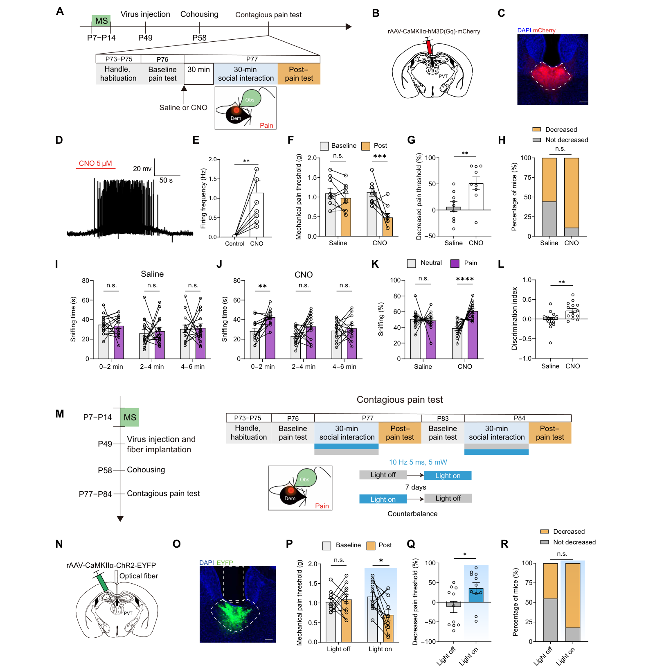
Increasing PVT activity restores impaired pain contagion
The researchers increased PVT neuronal activity in mice exposed to maternal separation. An excitatory chemogenetic receptor allowed selective recruitment of the targeted population. Electrical recordings confirmed increased neuronal firing after receptor activation. Observers then interacted with painful demonstrators in the same behavioral assay. The manipulation restored a greater decrease in the observer’s mechanical threshold following social contact.
This restoration addressed the lost contagious-pain response rather than the demonstrator’s inflammatory treatment. Neutral-partner controls separated ordinary social exposure from interaction with a painful partner. The observers’ discrimination between social states also improved under the activation condition. The combination connects social recognition with the threshold response. Reduced excitability can contribute to impaired processing of a partner’s condition.
Optogenetic activation supplied a second way to recruit the PVT population. Optogenetics uses light-sensitive proteins to change activity in genetically targeted cells. Channelrhodopsin activation permitted depolarization during the social assay. The resulting behavioral rescue converged with the chemogenetic intervention. Two different activation methods thus support a causal role for PVT recruitment in this preparation’s socially transferred sensitivity.
Zhang et al. (2025), Fig. 2C. The targeted PVT neuronal population.
Zhang et al. (2025), Fig. 4C–R. Chemogenetic and optogenetic rescue of observer responses.
Zhang et al. (2025)
25
Notes:
• The researchers increased PVT neuronal activity in mice exposed to maternal separation. An excitatory chemogenetic receptor allowed selective recruitment of the targeted population. Electrical recordings confirmed increased neuronal firing after receptor activation. Observers then interacted with painful demonstrators in the same behavioral assay. The manipulation restored a greater decrease in the observer’s mechanical threshold following social contact.
• This restoration addressed the lost contagious-pain response rather than the demonstrator’s inflammatory treatment. Neutral-partner controls separated ordinary social exposure from interaction with a painful partner. The observers’ discrimination between social states also improved under the activation condition. The combination connects social recognition with the threshold response. Reduced excitability can contribute to impaired processing of a partner’s condition.
• Optogenetic activation supplied a second way to recruit the PVT population. **Optogenetics** uses light-sensitive proteins to change activity in genetically targeted cells. Channelrhodopsin activation permitted depolarization during the social assay. The resulting behavioral rescue converged with the chemogenetic intervention. Two different activation methods thus support a causal role for PVT recruitment in this preparation’s socially transferred sensitivity.
References:
Zhang Z, Gong Y, Su XY, Su XY, Deng Y, Du R, Li CL, Wang Y, Song XL, Jiang Q, Li Y, Jian Y, Tong X, Wang GH, Chen J, Xu TL, Liu MG, Jiang F. (2025). Dysfunction of the paraventricular thalamus-prelimbic cortex circuit underlies maternal separation-induced deficits in contagious pain. Science advances 11(41):eady1944. https://doi.org/10.1126/sciadv.ady1944
Figure: Zhang et al. (2025), Fig. 4C–R. Chemogenetic and optogenetic rescue of observer responses.
Figure source: https://doi.org/10.1126/sciadv.ady1944
Figure: Zhang et al. (2025), Fig. 2C. The targeted PVT neuronal population.
Figure source: https://doi.org/10.1126/sciadv.ady1944

Slide 26
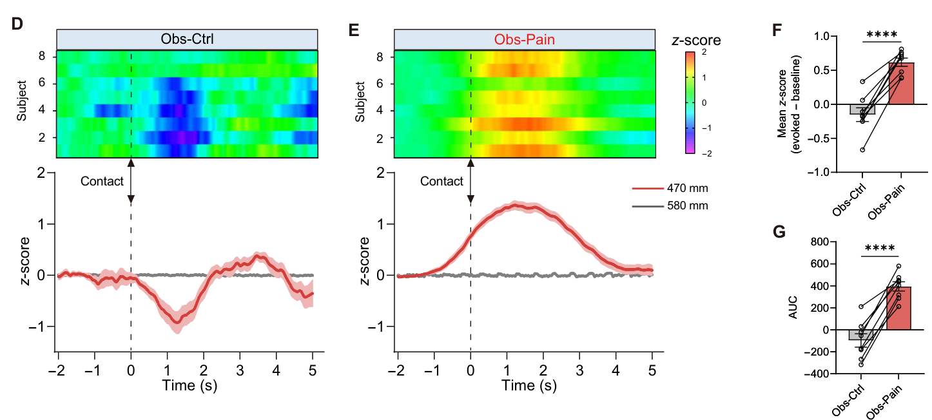
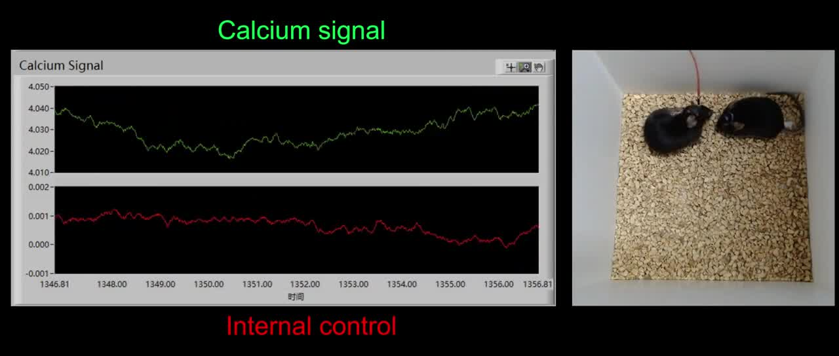
PVT signals reach prelimbic cortex during social contact
The prelimbic cortex, or PrL, is a medial prefrontal cortical region receiving PVT input. Researchers labeled PVT axons projecting to this cortical target. Fiber photometry measured pathway-associated calcium signals during observer contact with demonstrators. The signal increased more for painful than neutral social conditions. Movie S3 records this pathway measurement together with the interacting animals.
The calcium increase could begin before the scored body contact. This timing places pathway recruitment within the approach and contact sequence. A stronger signal accompanied the more salient demonstrator condition. The measurement therefore connects a defined thalamic output with processing of a partner’s state. It also distinguishes projection activity from a recording that pools every PVT output population.
Selective inhibition of PVT terminals in PrL blocked the socially induced mechanical hypersensitivity. It also impaired discrimination of the painful demonstrator in the exploration assay. Inhibiting a PVT projection to accumbens did not produce the corresponding effect in this study. The target comparison identifies a functionally important connection. The pathway through PrL links thalamic social-state processing with the observer’s later sensitivity.
Zhang et al. (2025), Fig. 5D–G. Contact-aligned calcium signals in the PVT-to-PrL pathway.
Zhang et al. (2025), Fig. 2C. The targeted PVT neuronal population.
Zhang et al. (2025), Movie S3. PVT-to-PrL pathway calcium activity during contact.
Zhang et al. (2025)
26
Notes:
• The **prelimbic cortex**, or PrL, is a medial prefrontal cortical region receiving PVT input. Researchers labeled PVT axons projecting to this cortical target. Fiber photometry measured pathway-associated calcium signals during observer contact with demonstrators. The signal increased more for painful than neutral social conditions. Movie S3 records this pathway measurement together with the interacting animals.
• The calcium increase could begin before the scored body contact. This timing places pathway recruitment within the approach and contact sequence. A stronger signal accompanied the more salient demonstrator condition. The measurement therefore connects a defined thalamic output with processing of a partner’s state. It also distinguishes projection activity from a recording that pools every PVT output population.
• Selective inhibition of PVT terminals in PrL blocked the socially induced mechanical hypersensitivity. It also impaired discrimination of the painful demonstrator in the exploration assay. Inhibiting a PVT projection to accumbens did not produce the corresponding effect in this study. The target comparison identifies a functionally important connection. The pathway through PrL links thalamic social-state processing with the observer’s later sensitivity.
References:
Zhang Z, Gong Y, Su XY, Su XY, Deng Y, Du R, Li CL, Wang Y, Song XL, Jiang Q, Li Y, Jian Y, Tong X, Wang GH, Chen J, Xu TL, Liu MG, Jiang F. (2025). Dysfunction of the paraventricular thalamus-prelimbic cortex circuit underlies maternal separation-induced deficits in contagious pain. Science advances 11(41):eady1944. https://doi.org/10.1126/sciadv.ady1944
Figure: Zhang et al. (2025), Fig. 5D–G. Contact-aligned calcium signals in the PVT-to-PrL pathway.
Figure source: https://doi.org/10.1126/sciadv.ady1944
Figure: Zhang et al. (2025), Fig. 2C. The targeted PVT neuronal population.
Figure source: https://doi.org/10.1126/sciadv.ady1944
Embedded video: Zhang et al. (2025), Movie S3. PVT-to-PrL pathway calcium activity during contact.
Exact source identifier: Movie S3
Article DOI: https://doi.org/10.1126/sciadv.ady1944
Original media URL: https://pmc-oa-opendata.s3.amazonaws.com/PMC12506963.1/sciadv.ady1944_movies_s1_to_s4.zip
Credit: Zhang Z, Gong Y, Su XY, Su XY, Deng Y, Du R, Li CL, Wang Y, Song XL, Jiang Q, Li Y, Jian Y, Tong X, Wang GH, Chen J, Xu TL, Liu MG, Jiang F. License: CC BY 4.0.
H.264/AAC compatibility conversion at original speed; original audio preserved; full recording retained. Poster is a source frame. Playback is full screen where the viewer supports it. Desktop PowerPoint GUI playback and Google Slides import remain untested. Google Slides may require separate Drive media insertion.

Slide 27
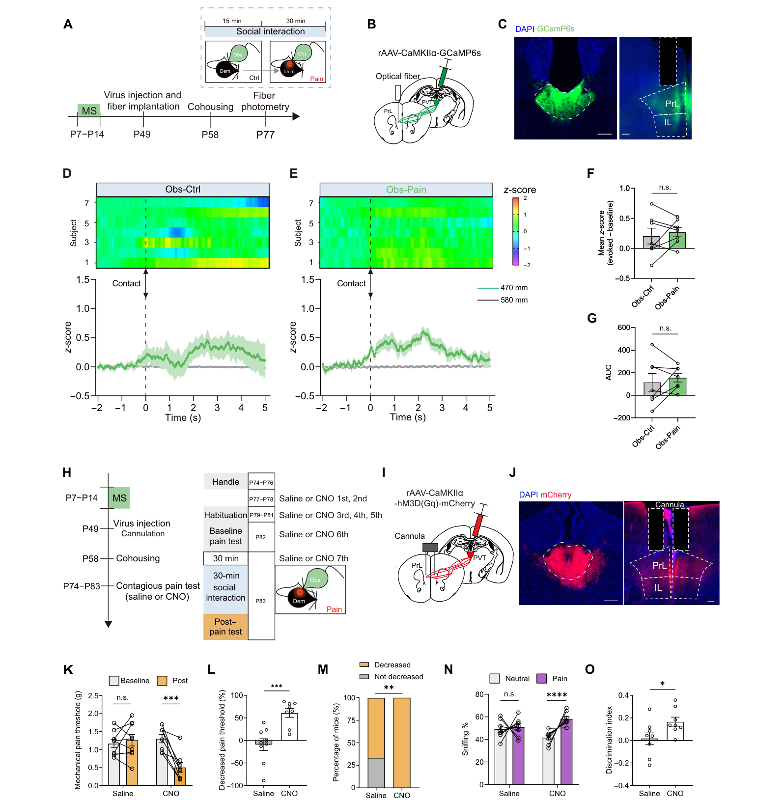
Recruiting the PVT-to-PrL pathway rescues social responses
Early-separated mice showed weakened recruitment of the PVT-to-PrL pathway during social interaction. The researchers compared neutral and painful demonstrator encounters while recording the projection-associated signal. The expected contact-related increase was reduced in the early-separated group. This pathway result matched the broader PVT population deficit. Developmental experience therefore affected a defined output carrying social information into prefrontal cortex.
The investigators selectively activated PrL-projecting PVT neurons using an intersectional viral strategy. Intersectional targeting restricts expression using more than one biological selection criterion. Here it combined neuronal location with the destination of the axon. Excitatory receptor activation increased activity in this selected pathway. The manipulation restored contagious mechanical hypersensitivity after exposure to the affected partner.
The pathway intervention also improved discrimination between neutral and painful demonstrators. A single connection thus influenced related social-recognition and sensitivity outcomes. The rescue did not require recreating the animal’s early rearing experience. Instead, it altered the adult circuit state during the current assay. The result ties the developmental deficit to a modifiable thalamic-prefrontal route.
Zhang et al. (2025), Fig. 2C. The targeted PVT neuronal population.
Zhang et al. (2025), Fig. 6C–M. Pathway activity and chemogenetic rescue after early separation.
Zhang et al. (2025)
27
Notes:
• Early-separated mice showed weakened recruitment of the PVT-to-PrL pathway during social interaction. The researchers compared neutral and painful demonstrator encounters while recording the projection-associated signal. The expected contact-related increase was reduced in the early-separated group. This pathway result matched the broader PVT population deficit. Developmental experience therefore affected a defined output carrying social information into prefrontal cortex.
• The investigators selectively activated PrL-projecting PVT neurons using an intersectional viral strategy. **Intersectional targeting** restricts expression using more than one biological selection criterion. Here it combined neuronal location with the destination of the axon. Excitatory receptor activation increased activity in this selected pathway. The manipulation restored contagious mechanical hypersensitivity after exposure to the affected partner.
• The pathway intervention also improved discrimination between neutral and painful demonstrators. A single connection thus influenced related social-recognition and sensitivity outcomes. The rescue did not require recreating the animal’s early rearing experience. Instead, it altered the adult circuit state during the current assay. The result ties the developmental deficit to a modifiable thalamic-prefrontal route.
References:
Zhang Z, Gong Y, Su XY, Su XY, Deng Y, Du R, Li CL, Wang Y, Song XL, Jiang Q, Li Y, Jian Y, Tong X, Wang GH, Chen J, Xu TL, Liu MG, Jiang F. (2025). Dysfunction of the paraventricular thalamus-prelimbic cortex circuit underlies maternal separation-induced deficits in contagious pain. Science advances 11(41):eady1944. https://doi.org/10.1126/sciadv.ady1944
Figure: Zhang et al. (2025), Fig. 6C–M. Pathway activity and chemogenetic rescue after early separation.
Figure source: https://doi.org/10.1126/sciadv.ady1944
Figure: Zhang et al. (2025), Fig. 2C. The targeted PVT neuronal population.
Figure source: https://doi.org/10.1126/sciadv.ady1944

Slide 28
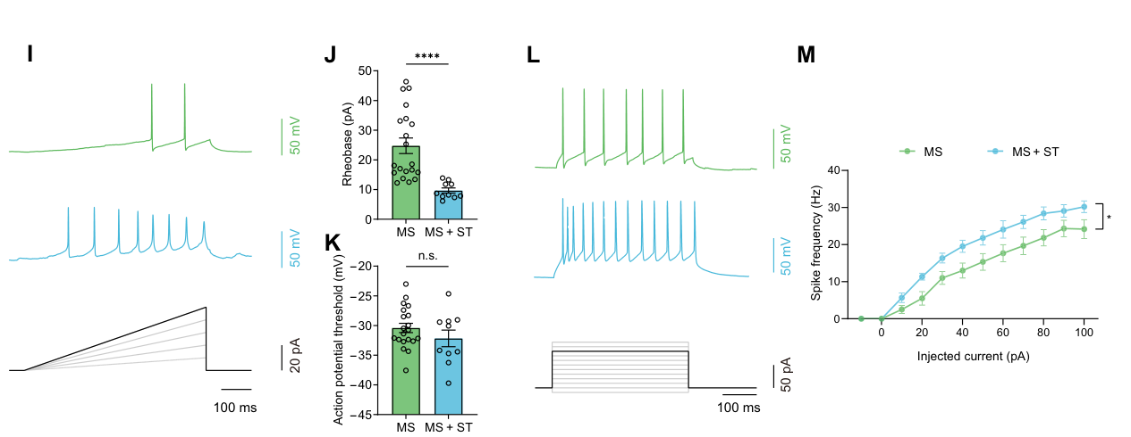
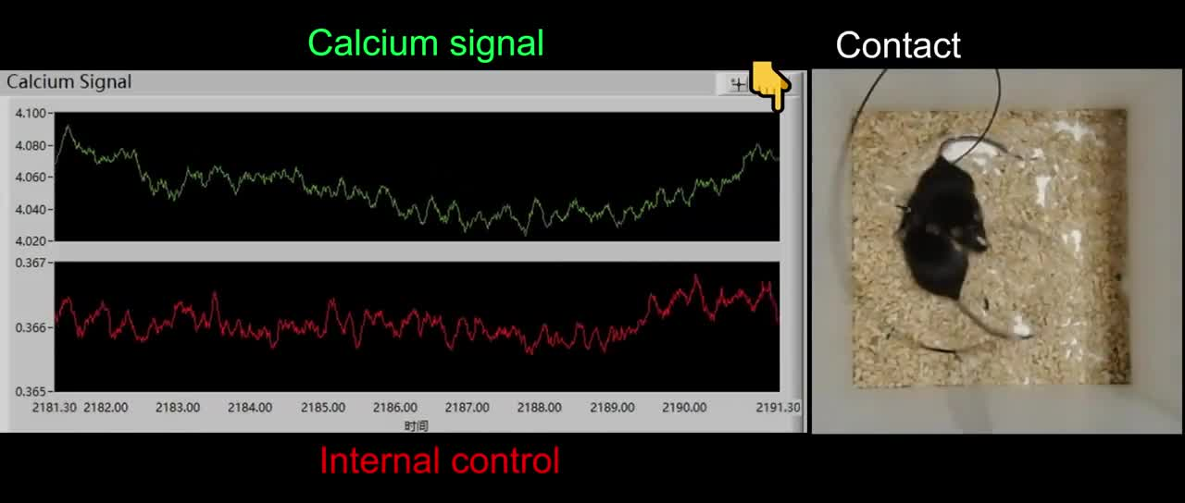
Tactile experience restores recruitment of a social circuit
The study tested repeated tactile stimulation intended to resemble positive social touch. Early-separated mice received this experience before the adult contagious-pain assay. The tactile intervention restored stronger discrimination of painful and neutral demonstrators. It also restored a larger socially induced decrease in mechanical threshold. The outcome concerns recovery of the impaired social response, rather than a general claim that touch always lowers sensitivity.
Whole-cell recordings examined PrL-projecting PVT neurons after the tactile intervention. Their firing increased during the tested depolarizing current injections. Rheobase was lower than in early-separated animals without the additional tactile experience. These cellular changes made the neurons easier to recruit. A behavioral experience therefore altered electrical properties of the same projection implicated by selective circuit manipulation.
Movie S4 records social contact and pathway activity after the tactile intervention. Contact-associated PVT-to-PrL calcium signals were stronger than in the untreated early-separated condition. The recording links the restored circuit response with the ongoing encounter. Physiology, pathway recording, and behavioral testing converge on the same adaptation. Experience can alter how an adult social circuit converts another animal’s state into the observer’s response.
Zhang et al. (2025), Fig. 7I–M. Excitability after social-touch-like tactile stimulation.
Zhang et al. (2025), Fig. 2C. The targeted PVT neuronal population.
Zhang et al. (2025), Movie S4. Pathway activity after tactile intervention.
Zhang et al. (2025)
28
Notes:
• The study tested repeated tactile stimulation intended to resemble positive social touch. Early-separated mice received this experience before the adult contagious-pain assay. The tactile intervention restored stronger discrimination of painful and neutral demonstrators. It also restored a larger socially induced decrease in mechanical threshold. The outcome concerns recovery of the impaired social response, rather than a general claim that touch always lowers sensitivity.
• Whole-cell recordings examined PrL-projecting PVT neurons after the tactile intervention. Their firing increased during the tested depolarizing current injections. Rheobase was lower than in early-separated animals without the additional tactile experience. These cellular changes made the neurons easier to recruit. A behavioral experience therefore altered electrical properties of the same projection implicated by selective circuit manipulation.
• Movie S4 records social contact and pathway activity after the tactile intervention. Contact-associated PVT-to-PrL calcium signals were stronger than in the untreated early-separated condition. The recording links the restored circuit response with the ongoing encounter. Physiology, pathway recording, and behavioral testing converge on the same adaptation. Experience can alter how an adult social circuit converts another animal’s state into the observer’s response.
References:
Zhang Z, Gong Y, Su XY, Su XY, Deng Y, Du R, Li CL, Wang Y, Song XL, Jiang Q, Li Y, Jian Y, Tong X, Wang GH, Chen J, Xu TL, Liu MG, Jiang F. (2025). Dysfunction of the paraventricular thalamus-prelimbic cortex circuit underlies maternal separation-induced deficits in contagious pain. Science advances 11(41):eady1944. https://doi.org/10.1126/sciadv.ady1944
Figure: Zhang et al. (2025), Fig. 7I–M. Excitability after social-touch-like tactile stimulation.
Figure source: https://doi.org/10.1126/sciadv.ady1944
Figure: Zhang et al. (2025), Fig. 2C. The targeted PVT neuronal population.
Figure source: https://doi.org/10.1126/sciadv.ady1944
Embedded video: Zhang et al. (2025), Movie S4. Pathway activity after tactile intervention.
Exact source identifier: Movie S4
Article DOI: https://doi.org/10.1126/sciadv.ady1944
Original media URL: https://pmc-oa-opendata.s3.amazonaws.com/PMC12506963.1/sciadv.ady1944_movies_s1_to_s4.zip
Credit: Zhang Z, Gong Y, Su XY, Su XY, Deng Y, Du R, Li CL, Wang Y, Song XL, Jiang Q, Li Y, Jian Y, Tong X, Wang GH, Chen J, Xu TL, Liu MG, Jiang F. License: CC BY 4.0.
H.264/AAC compatibility conversion at original speed; original audio preserved; full recording retained. Poster is a source frame. Playback is full screen where the viewer supports it. Desktop PowerPoint GUI playback and Google Slides import remain untested. Google Slides may require separate Drive media insertion.

Slide 29
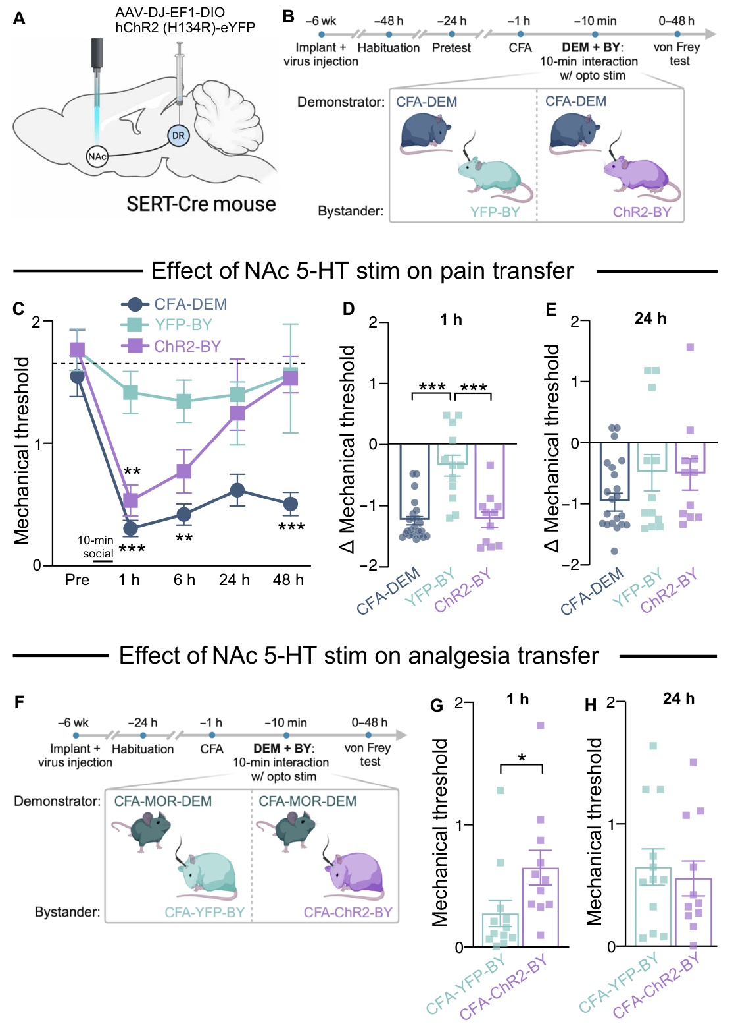
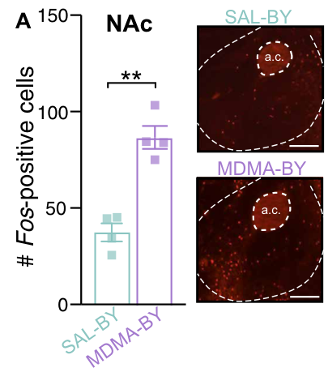
Accumbens serotonin strengthens social-state transfer
Rein and colleagues examined MDMA, a compound that increases release of monoamine neurotransmitters. They shortened the social encounter with a CFA demonstrator to 10 min. Under this abbreviated condition, saline-treated male bystanders showed little transfer. MDMA-treated male bystanders developed pronounced mechanical hypersensitivity afterward. The same treatment with a pain-free partner did not produce the corresponding threshold change.
The nucleus accumbens core is a ventral striatal target involved in processing socially relevant inputs. Local MDMA infusion reproduced enhanced social transfer. Serotonin, also called 5-HT, is a monoamine transmitter supplied by raphe neurons. Activating dorsal-raphe serotonin axons in accumbens reproduced the enhancement. This connected a specific transmitter input with altered responsiveness to a partner’s state.
The same serotonergic manipulation enhanced social transfer of analgesia in the tested male mice. It therefore strengthened transfer in either direction, depending on the demonstrator condition. Mechanical stimulation without the social encounter did not yield the same direct threshold effect. Females lacked enhanced transfer despite similarly increased accumbens serotonin. That difference restricts the reported enhancement to the tested male preparation.
Rein et al. (2024), Fig. 2A. Labeled accumbens core neurons after social transfer.
Rein et al. (2024), Fig. 3A–H. Serotonergic terminal activation and social-transfer outcomes.
Rein et al. (2024)
29
Notes:
• Rein and colleagues examined **MDMA**, a compound that increases release of monoamine neurotransmitters. They shortened the social encounter with a CFA demonstrator to 10 min. Under this abbreviated condition, saline-treated male bystanders showed little transfer. MDMA-treated male bystanders developed pronounced mechanical hypersensitivity afterward. The same treatment with a pain-free partner did not produce the corresponding threshold change.
• The **nucleus accumbens core** is a ventral striatal target involved in processing socially relevant inputs. Local MDMA infusion reproduced enhanced social transfer. **Serotonin**, also called 5-HT, is a monoamine transmitter supplied by raphe neurons. Activating dorsal-raphe serotonin axons in accumbens reproduced the enhancement. This connected a specific transmitter input with altered responsiveness to a partner’s state.
• The same serotonergic manipulation enhanced social transfer of analgesia in the tested male mice. It therefore strengthened transfer in either direction, depending on the demonstrator condition. Mechanical stimulation without the social encounter did not yield the same direct threshold effect. Females lacked enhanced transfer despite similarly increased accumbens serotonin. That difference restricts the reported enhancement to the tested male preparation.
References:
Rein B, Raymond K, Boustani C, Tuy S, Zhang J, St Laurent R, Pomrenze MB, Boroon P, Heifets B, Smith M, Malenka RC. (2024). MDMA enhances empathy-like behaviors in mice via 5-HT release in the nucleus accumbens. Science advances 10(17):eadl6554. https://doi.org/10.1126/sciadv.adl6554
Figure: Rein et al. (2024), Fig. 3A–H. Serotonergic terminal activation and social-transfer outcomes.
Figure source: https://doi.org/10.1126/sciadv.adl6554
Figure: Rein et al. (2024), Fig. 2A. Labeled accumbens core neurons after social transfer.
Figure source: https://doi.org/10.1126/sciadv.adl6554

Slide 30
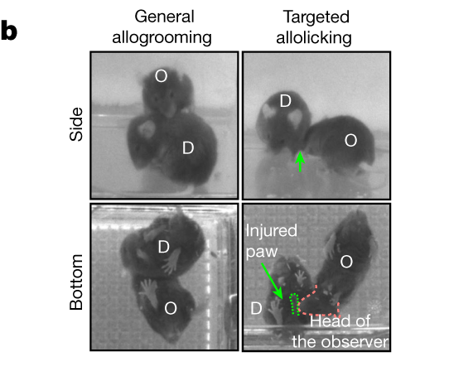
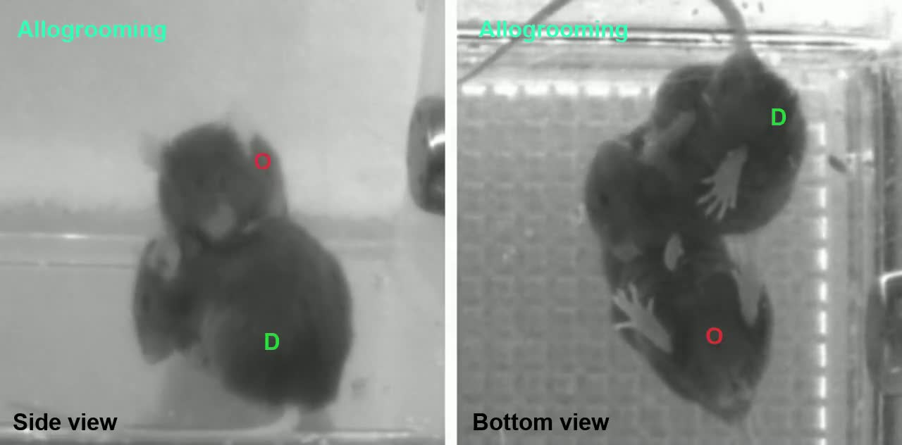
General grooming and injury-directed licking differ
Zhang and colleagues induced localized pain with melittin, a major peptide component of bee venom. One mouse received an injection in a hind paw before reunion with its cagemate. The untreated observer investigated the affected animal and then provided partner-directed care. General allogrooming targeted the neck, flank, and head. Supplementary Video 1 records this grooming response toward the demonstrator in pain.
General grooming differs from licking the particular injured paw. The investigators used side-view and bottom-view cameras to identify the contacted region. They measured the onset, duration, and number of bouts of each action. Social investigation was especially prominent early in the encounter. Grooming and injury-directed licking continued beyond this initial inspection period.
Both male and female observers increased partner-directed care toward melittin-treated demonstrators. An acute-restraint condition elicited grooming without the same injury-targeted licking. This contrast separates a general response to distress from a response localized to tissue injury. The observer’s behavior is therefore more specific than simply increasing all contact. The animal’s action depends on the type and location of the partner’s affected state.
Zhang et al. (2024), Fig. 1b. Distinct partner-directed actions after paw melittin injection.
Zhang et al. (2024), Supplementary Video 1. General allogrooming toward a partner in pain.
Zhang et al. (2024)
30
Notes:
• Zhang and colleagues induced localized pain with **melittin**, a major peptide component of bee venom. One mouse received an injection in a hind paw before reunion with its cagemate. The untreated observer investigated the affected animal and then provided partner-directed care. General allogrooming targeted the neck, flank, and head. Supplementary Video 1 records this grooming response toward the demonstrator in pain.
• General grooming differs from licking the particular injured paw. The investigators used side-view and bottom-view cameras to identify the contacted region. They measured the onset, duration, and number of bouts of each action. Social investigation was especially prominent early in the encounter. Grooming and injury-directed licking continued beyond this initial inspection period.
• Both male and female observers increased partner-directed care toward melittin-treated demonstrators. An acute-restraint condition elicited grooming without the same injury-targeted licking. This contrast separates a general response to distress from a response localized to tissue injury. The observer’s behavior is therefore more specific than simply increasing all contact. The animal’s action depends on the type and location of the partner’s affected state.
References:
Zhang M, Wu YE, Jiang M, Hong W. (2024). Cortical regulation of helping behaviour towards others in pain. Nature 626(7997):136-144. https://doi.org/10.1038/s41586-023-06973-x
Figure: Zhang et al. (2024), Fig. 1b. Distinct partner-directed actions after paw melittin injection.
Figure source: https://doi.org/10.1038/s41586-023-06973-x
Embedded video: Zhang et al. (2024), Supplementary Video 1. General allogrooming toward a partner in pain.
Exact source identifier: Supplementary Video 1
Article DOI: https://doi.org/10.1038/s41586-023-06973-x
Original media URL: https://media.springernature.com/original/springer-static/esm/art%3A10.1038%2Fs41586-023-06973-x/MediaObjects/41586_2023_6973_MOESM3_ESM.mp4
Credit: Zhang M, Wu YE, Jiang M, Hong W. License: Original publisher recording; no open license stated in author manuscript.
H.264/AAC compatibility conversion at original speed; original audio preserved; full recording retained. Poster is a source frame. Playback is full screen where the viewer supports it. Desktop PowerPoint GUI playback and Google Slides import remain untested. Google Slides may require separate Drive media insertion.

Slide 31
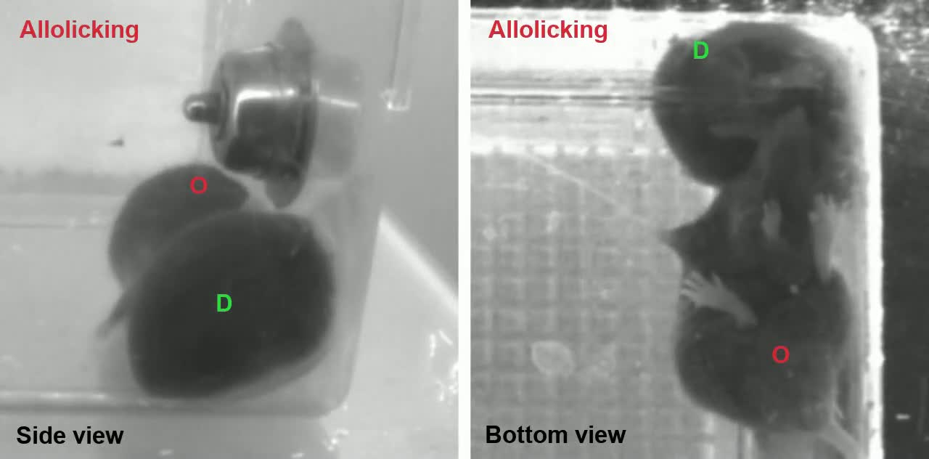
Allolicking targets the partner’s injured paw
The untreated observer directed allolicking toward the demonstrator’s melittin-injected paw. Other, uninjected paws received much less of this behavior. Supplementary Video 2 records the injury-directed interaction from the original experiment. Side-view and bottom-view images permitted the paw target to be identified. The spatial selectivity links the observer’s movement with the demonstrator’s localized condition.
A digital gyroscope measured head movements during the two forms of care. General allogrooming involved rhythmic head bobbing. Injury-directed allolicking had a different movement pattern in this preparation. Thus the behaviors differed in both body target and motor organization. The distinction allowed neuronal activity to be compared during two separately defined social actions.
Formalin-treated demonstrators also elicited injury-directed licking from observers. The result generalized beyond melittin as the sole chemical preparation. Acute restraint without a localized injury elicited general grooming instead. The source condition consequently determined which action the observer performed. Partner-directed licking can be organized around a specific affected body region rather than a nonspecific response to another animal’s distress.
Zhang et al. (2024), Fig. 1b. Selective allolicking of the melittin-injected paw.
Zhang et al. (2024), Supplementary Video 2. Targeted allolicking of an injured paw.
Zhang et al. (2024)
31
Notes:
• The untreated observer directed allolicking toward the demonstrator’s melittin-injected paw. Other, uninjected paws received much less of this behavior. Supplementary Video 2 records the injury-directed interaction from the original experiment. Side-view and bottom-view images permitted the paw target to be identified. The spatial selectivity links the observer’s movement with the demonstrator’s localized condition.
• A digital gyroscope measured head movements during the two forms of care. General allogrooming involved rhythmic head bobbing. Injury-directed allolicking had a different movement pattern in this preparation. Thus the behaviors differed in both body target and motor organization. The distinction allowed neuronal activity to be compared during two separately defined social actions.
• Formalin-treated demonstrators also elicited injury-directed licking from observers. The result generalized beyond melittin as the sole chemical preparation. Acute restraint without a localized injury elicited general grooming instead. The source condition consequently determined which action the observer performed. Partner-directed licking can be organized around a specific affected body region rather than a nonspecific response to another animal’s distress.
References:
Zhang M, Wu YE, Jiang M, Hong W. (2024). Cortical regulation of helping behaviour towards others in pain. Nature 626(7997):136-144. https://doi.org/10.1038/s41586-023-06973-x
Figure: Zhang et al. (2024), Fig. 1b. Selective allolicking of the melittin-injected paw.
Figure source: https://doi.org/10.1038/s41586-023-06973-x
Embedded video: Zhang et al. (2024), Supplementary Video 2. Targeted allolicking of an injured paw.
Exact source identifier: Supplementary Video 2
Article DOI: https://doi.org/10.1038/s41586-023-06973-x
Original media URL: https://media.springernature.com/original/springer-static/esm/art%3A10.1038%2Fs41586-023-06973-x/MediaObjects/41586_2023_6973_MOESM4_ESM.mp4
Credit: Zhang M, Wu YE, Jiang M, Hong W. License: Original publisher recording; no open license stated in author manuscript.
H.264/AAC compatibility conversion at original speed; original audio preserved; full recording retained. Poster is a source frame. Playback is full screen where the viewer supports it. Desktop PowerPoint GUI playback and Google Slides import remain untested. Google Slides may require separate Drive media insertion.

Slide 32
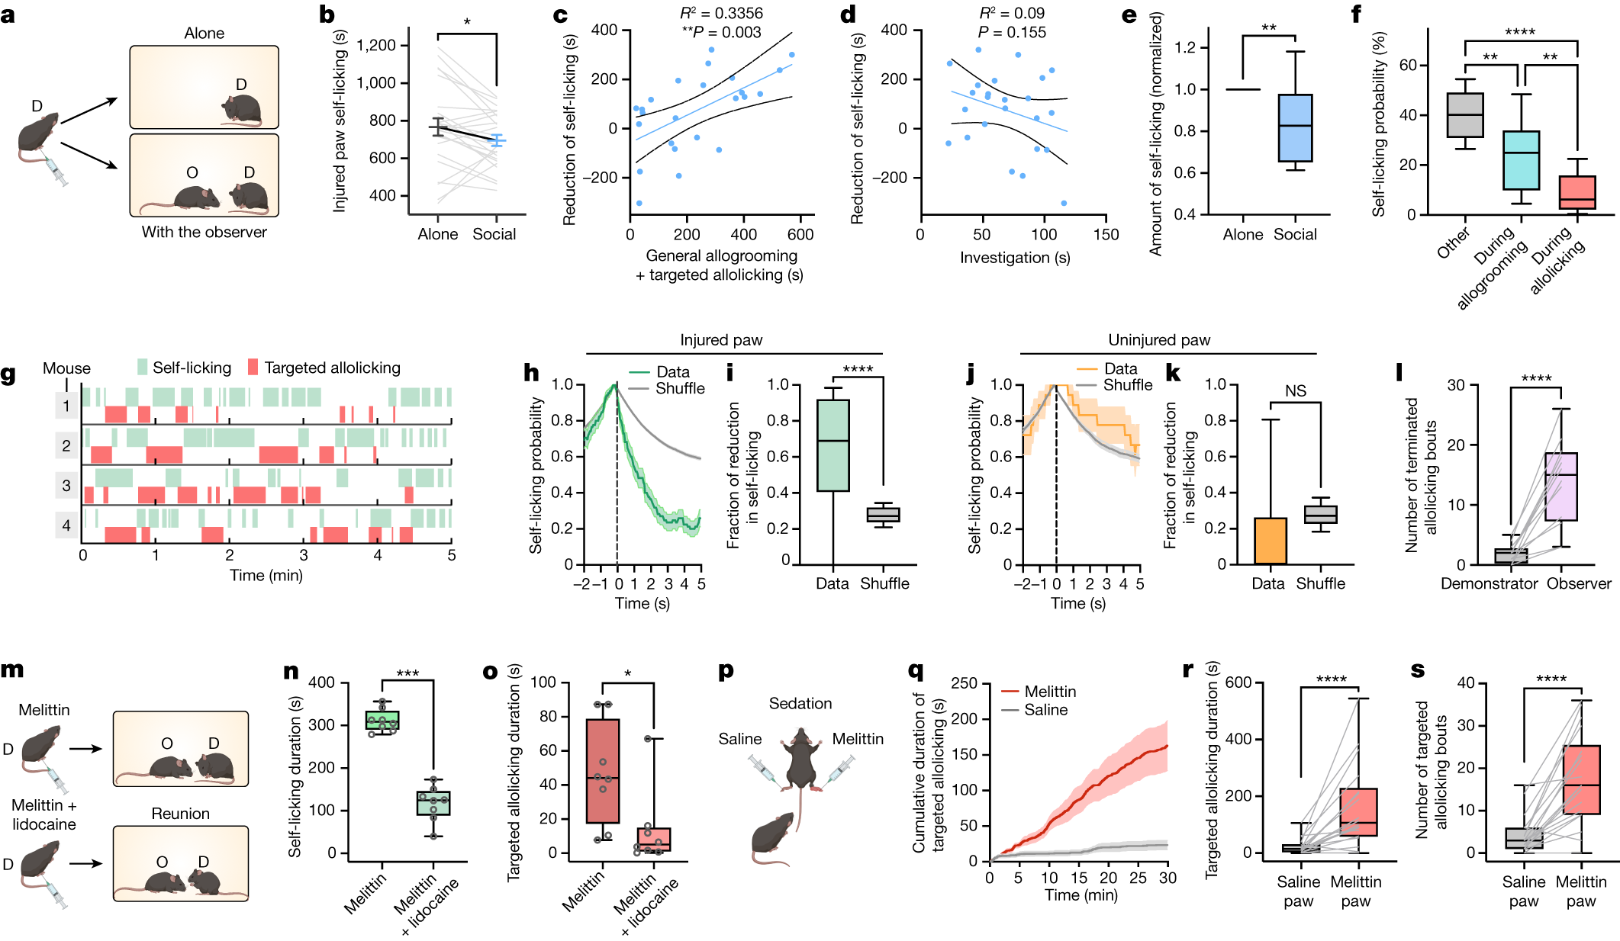
Partner licking reduces the recipient’s self-licking
Demonstrators licked their own injured paw when housed alone after melittin treatment. With an observer present, their total self-licking decreased. The reduction was associated with the amount of care supplied by the observer. Ordinary social investigation did not predict the same reduction. The comparison distinguishes the recipient’s response to actual partner-directed care from the mere presence of another mouse.
The probability of self-licking fell during bouts of received allolicking. The decrease was greater than during general grooming elsewhere on the body. Injury-targeted licking also accelerated the decline beyond the natural termination of self-licking. Licking an uninjured paw did not produce the same temporal relationship. These comparisons localize the effect to care directed at the affected region.
In most bouts, the observer voluntarily ended the allolicking. The demonstrator seldom terminated the interaction by avoiding the observer. The authors hypothesize that partner licking partly fulfills the recipient’s need for self-directed pain-coping behavior. The measured reduction is in self-licking, rather than a direct report of subjective pain. This qualification matters because the same motor outcome could otherwise be misread as a complete measure of analgesia.
Geng et al. (2026), Fig. 1A. The mouse social-interaction preparation.
Zhang et al. (2024), Fig. 2b–l. Recipient self-licking during observer-directed care.
Zhang et al. (2024)
32
Notes:
• Demonstrators licked their own injured paw when housed alone after melittin treatment. With an observer present, their total self-licking decreased. The reduction was associated with the amount of care supplied by the observer. Ordinary social investigation did not predict the same reduction. The comparison distinguishes the recipient’s response to actual partner-directed care from the mere presence of another mouse.
• The probability of self-licking fell during bouts of received allolicking. The decrease was greater than during general grooming elsewhere on the body. Injury-targeted licking also accelerated the decline beyond the natural termination of self-licking. Licking an uninjured paw did not produce the same temporal relationship. These comparisons localize the effect to care directed at the affected region.
• In most bouts, the observer voluntarily ended the allolicking. The demonstrator seldom terminated the interaction by avoiding the observer. The authors hypothesize that partner licking partly fulfills the recipient’s need for self-directed pain-coping behavior. The measured reduction is in self-licking, rather than a direct report of subjective pain. This qualification matters because the same motor outcome could otherwise be misread as a complete measure of analgesia.
References:
Zhang M, Wu YE, Jiang M, Hong W. (2024). Cortical regulation of helping behaviour towards others in pain. Nature 626(7997):136-144. https://doi.org/10.1038/s41586-023-06973-x
Geng KW, Wang RR, Yang Y, Wang Y, He T, Li CL, Xu CS, Chen J. (2026). Hypothalamic-amygdala gating of caregiving-like prosocial behavior in mice. The Journal of clinical investigation 136(19):e204317. https://doi.org/10.1172/jci204317
Figure: Zhang et al. (2024), Fig. 2b–l. Recipient self-licking during observer-directed care.
Figure source: https://doi.org/10.1038/s41586-023-06973-x
Figure: Geng et al. (2026), Fig. 1A. The mouse social-interaction preparation.
Figure source: https://doi.org/10.1172/jci204317

Slide 33
Local injury cues remain informative during sedation
The investigators first combined melittin with lidocaine in awake demonstrators. Local anesthesia greatly reduced the demonstrator’s self-licking. Observers correspondingly provided less injury-directed allolicking. This links the visible pain-coping response with rapid localization of the affected paw. It complements the experiment in which the same injury was present without suppressing the demonstrator’s behavior.
A separate condition sedated the demonstrator after melittin injection. The injured paw retained swelling and inflammation, but the animal did not self-lick. Observers could still eventually direct licking toward that affected paw. They took longer to distinguish it from an uninjected paw than during interaction with an awake demonstrator. Visible behavior thus accelerated identification but was not the only available signal.
The authors propose local chemical and tactile cues as contributors in the sedated condition. Those cue identities remain hypotheses because the experiment did not isolate a specific molecule or receptor. The source manipulation instead established that ongoing self-licking was unnecessary for eventual localization. Information can arrive from the injury region as well as the demonstrator’s active display. Multiple sensory routes can consequently support a body-specific social response.
Geng et al. (2026), Fig. 1A. The mouse social-interaction preparation.
Zhang et al. (2024), Fig. 2m–s. Lidocaine and sedation tests of injury-directed care.
Zhang et al. (2024)
33
Notes:
• The investigators first combined melittin with lidocaine in awake demonstrators. Local anesthesia greatly reduced the demonstrator’s self-licking. Observers correspondingly provided less injury-directed allolicking. This links the visible pain-coping response with rapid localization of the affected paw. It complements the experiment in which the same injury was present without suppressing the demonstrator’s behavior.
• A separate condition sedated the demonstrator after melittin injection. The injured paw retained swelling and inflammation, but the animal did not self-lick. Observers could still eventually direct licking toward that affected paw. They took longer to distinguish it from an uninjected paw than during interaction with an awake demonstrator. Visible behavior thus accelerated identification but was not the only available signal.
• The authors propose local chemical and tactile cues as contributors in the sedated condition. Those cue identities remain hypotheses because the experiment did not isolate a specific molecule or receptor. The source manipulation instead established that ongoing self-licking was unnecessary for eventual localization. Information can arrive from the injury region as well as the demonstrator’s active display. Multiple sensory routes can consequently support a body-specific social response.
References:
Zhang M, Wu YE, Jiang M, Hong W. (2024). Cortical regulation of helping behaviour towards others in pain. Nature 626(7997):136-144. https://doi.org/10.1038/s41586-023-06973-x
Geng KW, Wang RR, Yang Y, Wang Y, He T, Li CL, Xu CS, Chen J. (2026). Hypothalamic-amygdala gating of caregiving-like prosocial behavior in mice. The Journal of clinical investigation 136(19):e204317. https://doi.org/10.1172/jci204317
Figure: Zhang et al. (2024), Fig. 2m–s. Lidocaine and sedation tests of injury-directed care.
Figure source: https://doi.org/10.1038/s41586-023-06973-x
Figure: Geng et al. (2026), Fig. 1A. The mouse social-interaction preparation.
Figure source: https://doi.org/10.1172/jci204317

Slide 34
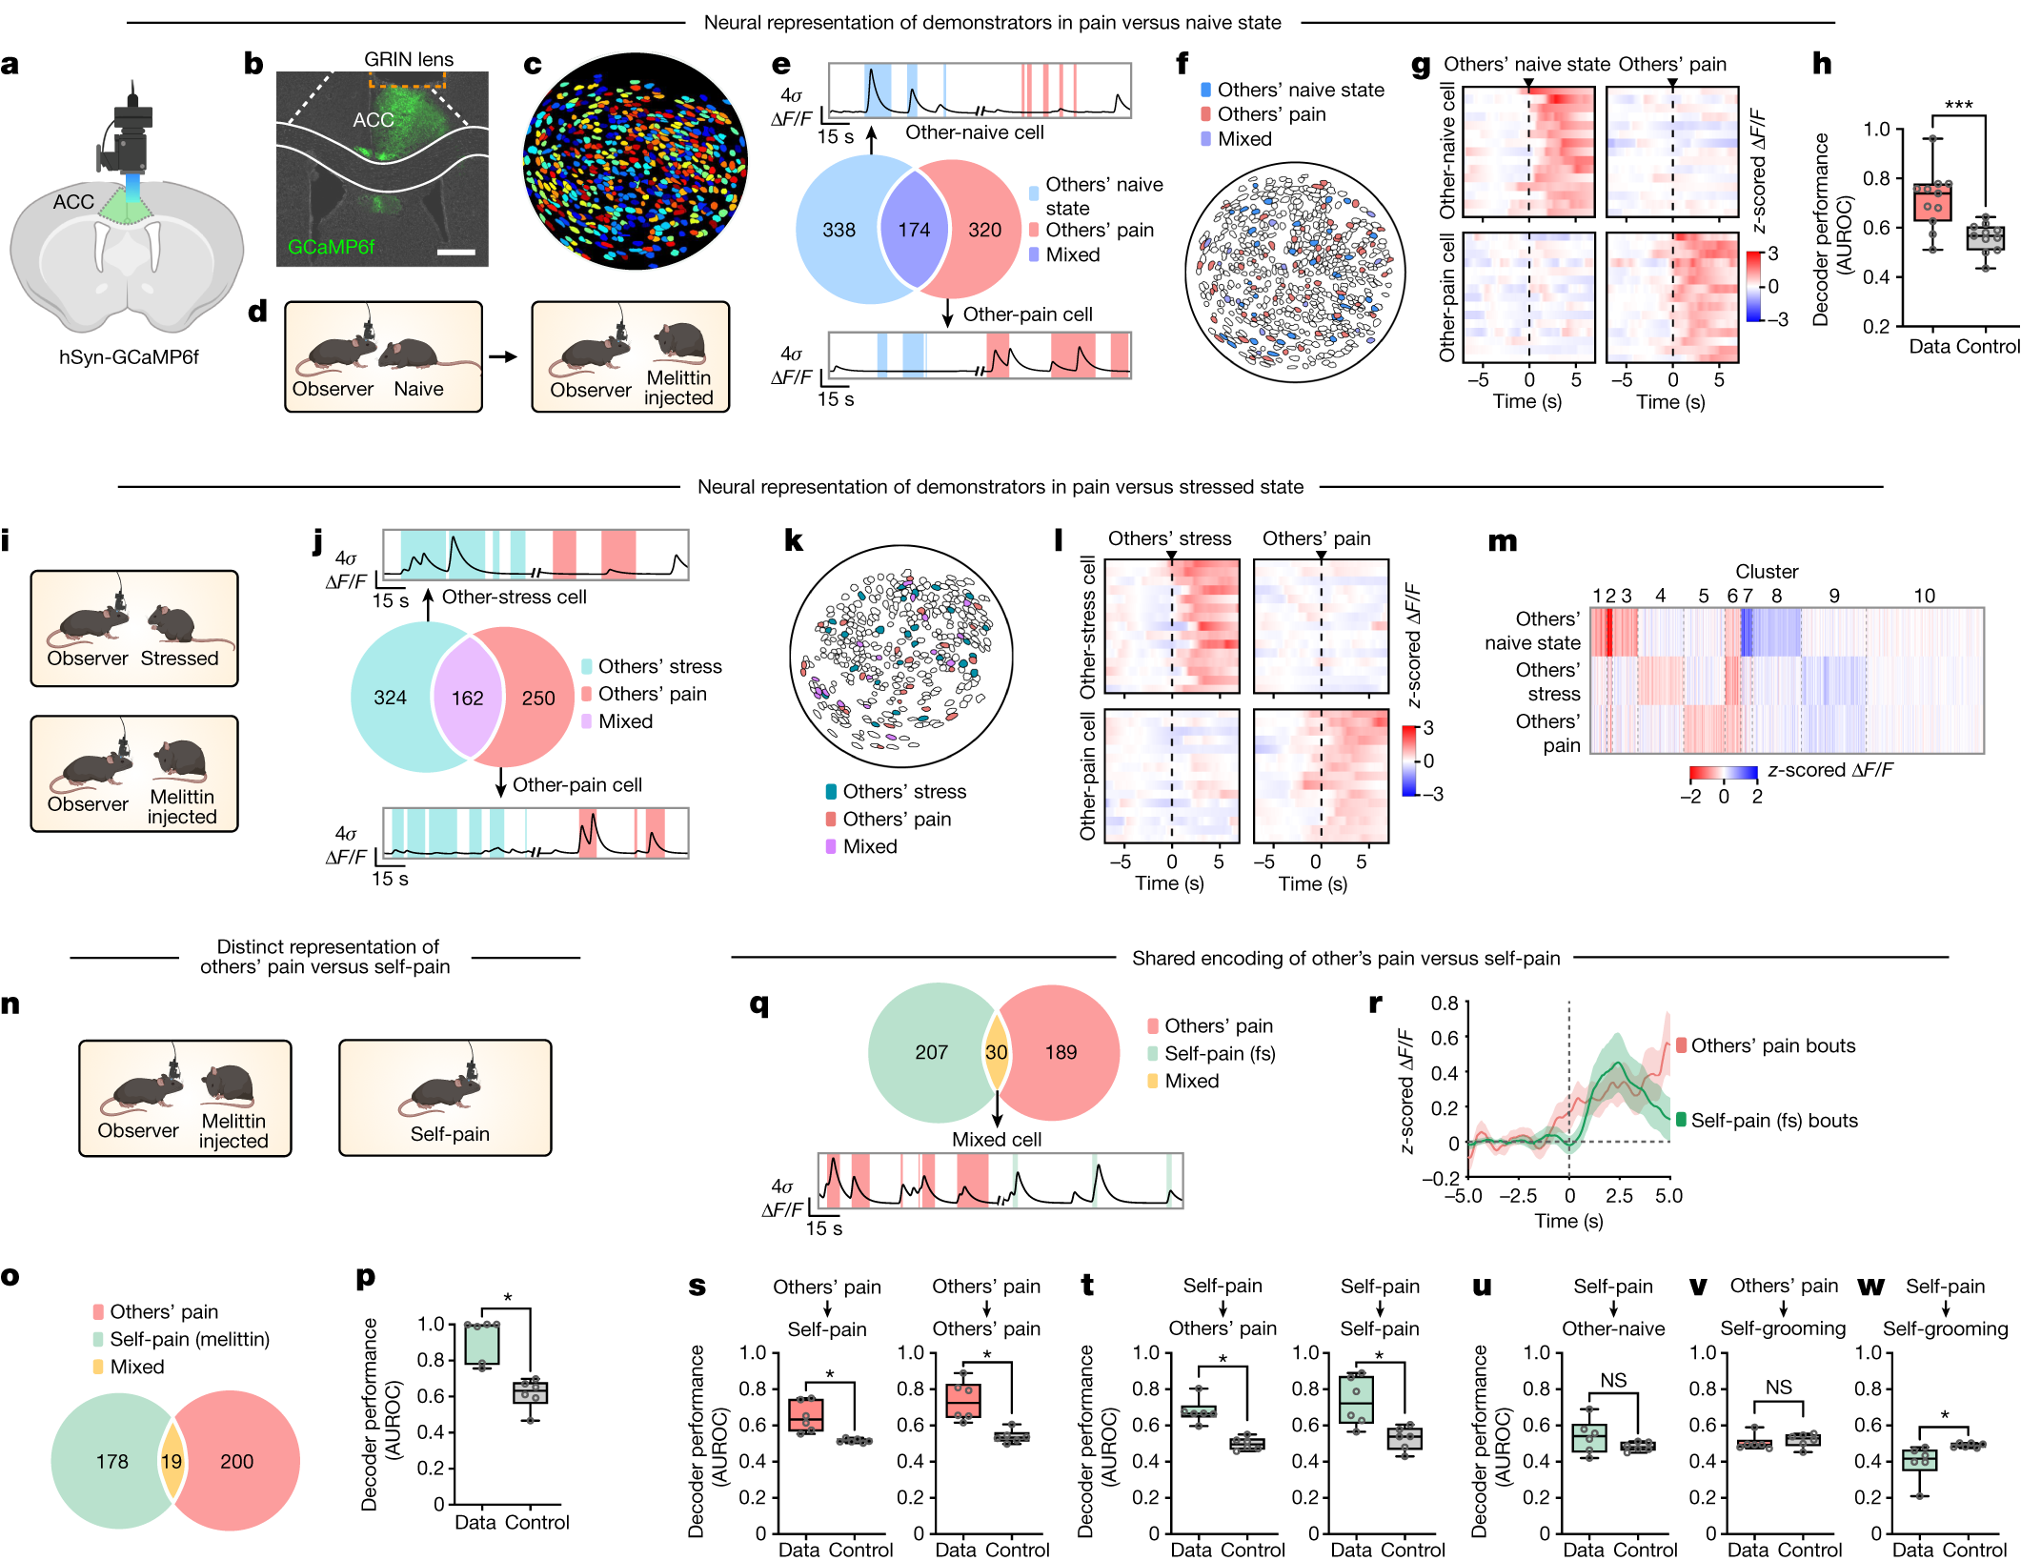
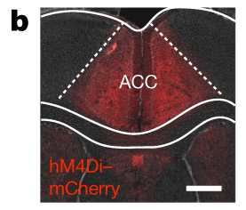
ACC populations distinguish pain from general stress
The researchers imaged individual anterior cingulate cortex neurons during free social interaction. The anterior cingulate cortex, or ACC, is a medial cortical region involved in affective and social processing. A miniature endoscope collected GCaMP6f fluorescence through an implanted lens. Microendoscopic imaging records identifiable cells across behavioral conditions. Observers encountered neutral, restrained, and melittin-treated partners.
Different ACC populations responded preferentially to neutral, stressed, or painful social targets. Many pain-responsive and stress-responsive cells were distinct despite being spatially intermixed. Some cells responded across more than one social condition. Population activity discriminated the partner’s state above baseline. The cortex contained both specialized responses and shared information.
The investigators also compared activity during general grooming and injury-directed licking. These actions recruited largely separate populations of ACC neurons. Their distinction exceeded the difference between grooming stressed and painful partners. Population coding means information carried by the joint activity of many neurons. Cortical activity therefore reflected both the perceived social state and the particular action organized in response to it.
Zhang et al. (2024), Fig. 4b. The targeted anterior cingulate cortex tissue.
Zhang et al. (2024), Fig. 3b–m. Single-cell calcium responses to different demonstrator states.
Zhang et al. (2024)
34
Notes:
• The researchers imaged individual anterior cingulate cortex neurons during free social interaction. The **anterior cingulate cortex**, or ACC, is a medial cortical region involved in affective and social processing. A miniature endoscope collected GCaMP6f fluorescence through an implanted lens. **Microendoscopic imaging** records identifiable cells across behavioral conditions. Observers encountered neutral, restrained, and melittin-treated partners.
• Different ACC populations responded preferentially to neutral, stressed, or painful social targets. Many pain-responsive and stress-responsive cells were distinct despite being spatially intermixed. Some cells responded across more than one social condition. Population activity discriminated the partner’s state above baseline. The cortex contained both specialized responses and shared information.
• The investigators also compared activity during general grooming and injury-directed licking. These actions recruited largely separate populations of ACC neurons. Their distinction exceeded the difference between grooming stressed and painful partners. **Population coding** means information carried by the joint activity of many neurons. Cortical activity therefore reflected both the perceived social state and the particular action organized in response to it.
References:
Zhang M, Wu YE, Jiang M, Hong W. (2024). Cortical regulation of helping behaviour towards others in pain. Nature 626(7997):136-144. https://doi.org/10.1038/s41586-023-06973-x
Figure: Zhang et al. (2024), Fig. 3b–m. Single-cell calcium responses to different demonstrator states.
Figure source: https://doi.org/10.1038/s41586-023-06973-x
Figure: Zhang et al. (2024), Fig. 4b. The targeted anterior cingulate cortex tissue.
Figure source: https://doi.org/10.1038/s41586-023-06973-x

Slide 35
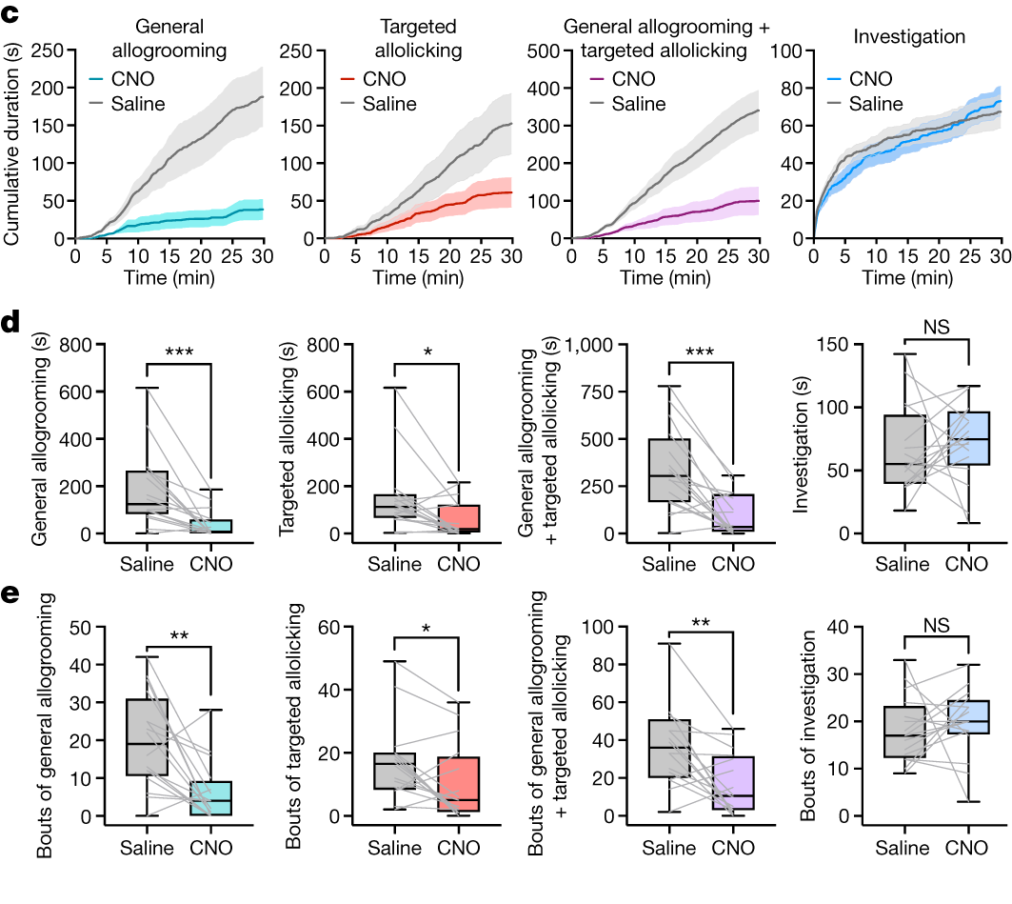
ACC manipulation selectively changes partner-directed care
Chemogenetic inhibition reduced both general grooming and injury-directed allolicking toward melittin-treated demonstrators. The researchers expressed the inhibitory receptor hM4Di in observer ACC neurons. They compared ligand administration with saline and receptor-expression controls. The intervention did not comparably reduce ordinary investigation of the partner. Thus the change concerned care behavior rather than a general loss of social contact.
Optogenetic activation of ACC pyramidal neurons increased partner-directed care. Pyramidal neurons are excitatory cortical projection cells targeted selectively here. ChR2 allowed light to depolarize the expressing cells. Injury-directed licking still targeted the melittin-injected paw during stimulation. Increasing cortical activity therefore enhanced the organized response without removing its dependence on a locally affected partner.
Activation of neighboring prelimbic cortex did not produce the same increase in care. ACC activation also did not increase the treated observer’s own self-licking. Those controls distinguish social care from a generic licking command. The result extends the recording evidence into a causal circuit contribution. The cortex coordinates care while retaining information about self, other, and contact target.
Zhang et al. (2024), Fig. 4b. The targeted anterior cingulate cortex tissue.
Zhang et al. (2024), Fig. 4c–e. Inhibition and activation of ACC during helping behavior.
Zhang et al. (2024)
35
Notes:
• Chemogenetic inhibition reduced both general grooming and injury-directed allolicking toward melittin-treated demonstrators. The researchers expressed the inhibitory receptor hM4Di in observer ACC neurons. They compared ligand administration with saline and receptor-expression controls. The intervention did not comparably reduce ordinary investigation of the partner. Thus the change concerned care behavior rather than a general loss of social contact.
• Optogenetic activation of ACC pyramidal neurons increased partner-directed care. **Pyramidal neurons** are excitatory cortical projection cells targeted selectively here. ChR2 allowed light to depolarize the expressing cells. Injury-directed licking still targeted the melittin-injected paw during stimulation. Increasing cortical activity therefore enhanced the organized response without removing its dependence on a locally affected partner.
• Activation of neighboring prelimbic cortex did not produce the same increase in care. ACC activation also did not increase the treated observer’s own self-licking. Those controls distinguish social care from a generic licking command. The result extends the recording evidence into a causal circuit contribution. The cortex coordinates care while retaining information about self, other, and contact target.
References:
Zhang M, Wu YE, Jiang M, Hong W. (2024). Cortical regulation of helping behaviour towards others in pain. Nature 626(7997):136-144. https://doi.org/10.1038/s41586-023-06973-x
Figure: Zhang et al. (2024), Fig. 4c–e. Inhibition and activation of ACC during helping behavior.
Figure source: https://doi.org/10.1038/s41586-023-06973-x
Figure: Zhang et al. (2024), Fig. 4b. The targeted anterior cingulate cortex tissue.
Figure source: https://doi.org/10.1038/s41586-023-06973-x

Slide 36
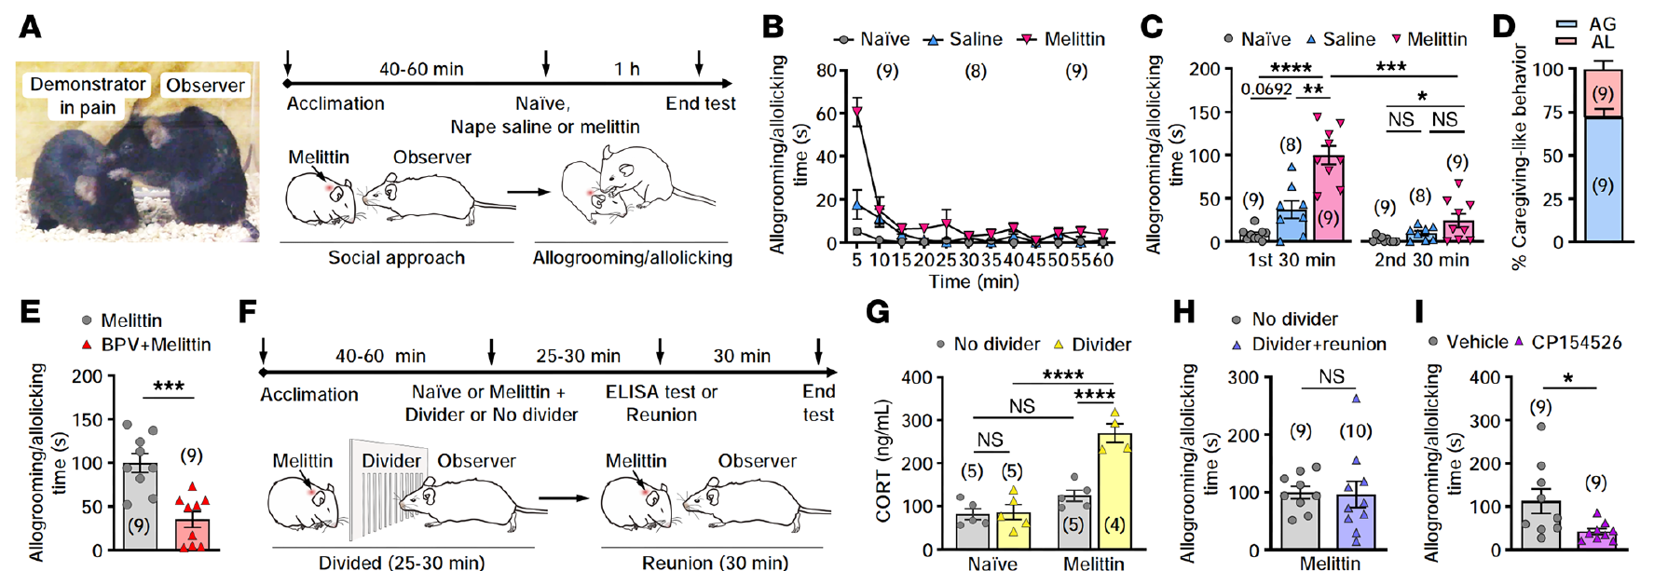
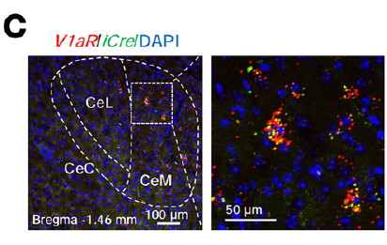

Caregiving couples shared stress with partner care
Geng and colleagues injected melittin into a demonstrator’s nape rather than its paw. Familiar observers approached the affected partner and provided prolonged care after reunion. Approximately 72% of the scored care consisted of general allogrooming. The remaining 28% consisted of licking directed at the injured region. Supplemental Video 1 records the naturally occurring interaction in this preparation.
A transparent divider allowed sight, smell, and sound while preventing physical touch. Observers behind the divider had higher plasma corticosterone than observers able to provide care. Corticosterone is a glucocorticoid hormone used here to assess the stress response. After the divider was removed, observers resumed partner-directed grooming and licking. The comparison links contact availability with the observer’s own physiological state.
Pretreatment blocking corticotropin-releasing-factor receptor 1 reduced subsequent care. This receptor participates in stress-response signaling. The authors hypothesize that shared anxiety helps initiate the care response. The injury recipient and caregiver can therefore experience different consequences of the same encounter. Social-state matching can motivate contact that subsequently buffers the caregiver’s stress while acting on the affected partner.
Geng et al. (2026), Fig. 1A–I. Care after nape melittin and the physical-divider comparison.
Geng et al. (2026), Fig. 3C. V1aR-expressing neurons in the central amygdala.
Geng et al. (2026), Supplemental Video 1. Spontaneous grooming and injury-directed licking.
Geng et al. (2026)
36
Notes:
• Geng and colleagues injected melittin into a demonstrator’s nape rather than its paw. Familiar observers approached the affected partner and provided prolonged care after reunion. Approximately 72% of the scored care consisted of general allogrooming. The remaining 28% consisted of licking directed at the injured region. Supplemental Video 1 records the naturally occurring interaction in this preparation.
• A transparent divider allowed sight, smell, and sound while preventing physical touch. Observers behind the divider had higher plasma corticosterone than observers able to provide care. **Corticosterone** is a glucocorticoid hormone used here to assess the stress response. After the divider was removed, observers resumed partner-directed grooming and licking. The comparison links contact availability with the observer’s own physiological state.
• Pretreatment blocking corticotropin-releasing-factor receptor 1 reduced subsequent care. This receptor participates in stress-response signaling. The authors hypothesize that shared anxiety helps initiate the care response. The injury recipient and caregiver can therefore experience different consequences of the same encounter. Social-state matching can motivate contact that subsequently buffers the caregiver’s stress while acting on the affected partner.
References:
Geng KW, Wang RR, Yang Y, Wang Y, He T, Li CL, Xu CS, Chen J. (2026). Hypothalamic-amygdala gating of caregiving-like prosocial behavior in mice. The Journal of clinical investigation 136(19):e204317. https://doi.org/10.1172/jci204317
Figure: Geng et al. (2026), Fig. 1A–I. Care after nape melittin and the physical-divider comparison.
Figure source: https://doi.org/10.1172/jci204317
Figure: Geng et al. (2026), Fig. 3C. V1aR-expressing neurons in the central amygdala.
Figure source: https://doi.org/10.1172/jci204317
Embedded video: Geng et al. (2026), Supplemental Video 1. Spontaneous grooming and injury-directed licking.
Exact source identifier: Supplemental Video 1
Article DOI: https://doi.org/10.1172/jci204317
Original media URL: https://pmc-oa-opendata.s3.amazonaws.com/PMC13626834.1/jci-136-204317-s011.mp4
Credit: Geng KW, Wang RR, Yang Y, Wang Y, He T, Li CL, Xu CS, Chen J. License: CC BY 4.0.
H.264/AAC compatibility conversion at original speed; original audio preserved; full recording retained. Poster is a source frame. Playback is full screen where the viewer supports it. Desktop PowerPoint GUI playback and Google Slides import remain untested. Google Slides may require separate Drive media insertion.

Slide 37


CeM V1aR cells respond during social investigation
The medial central amygdala, or CeM, is an output region within the central amygdala. The investigators identified neurons expressing vasopressin receptor 1a, abbreviated V1aR. Genetic targeting allowed a calcium sensor to be expressed in this receptor-defined population. Fluorescent histology verified the targeted cells in the CeM. Population activity was recorded with neutral and painful partners.
Supplemental Video 2 records the early social-investigation phase with the calcium trace. Encountering a partner in pain produced a rapid, sustained increase in the V1aR-cell signal. The initial response lasted for tens of seconds during investigation. It was stronger and more persistent than the response to a neutral cagemate. The population consequently carried information about partner condition during the approach sequence.
Both male and female observers showed this state-related recruitment in the tested preparation. The measurement preceded or accompanied later grooming and injury-directed licking. It therefore separates initial social-state processing from a recording restricted to the execution of care. A receptor-defined amygdala population can contribute at multiple stages of the encounter. Its activity connects perceived distress with the transition into partner-directed behavior.
Geng et al. (2026), Fig. 3H–J. CeM V1aR calcium activity during initial social investigation.
Geng et al. (2026), Fig. 3C. V1aR-expressing neurons in the central amygdala.
Geng et al. (2026), Supplemental Video 2. CeM V1aR calcium activity during social investigation.
Geng et al. (2026)
37
Notes:
• The **medial central amygdala**, or CeM, is an output region within the central amygdala. The investigators identified neurons expressing vasopressin receptor 1a, abbreviated **V1aR**. Genetic targeting allowed a calcium sensor to be expressed in this receptor-defined population. Fluorescent histology verified the targeted cells in the CeM. Population activity was recorded with neutral and painful partners.
• Supplemental Video 2 records the early social-investigation phase with the calcium trace. Encountering a partner in pain produced a rapid, sustained increase in the V1aR-cell signal. The initial response lasted for tens of seconds during investigation. It was stronger and more persistent than the response to a neutral cagemate. The population consequently carried information about partner condition during the approach sequence.
• Both male and female observers showed this state-related recruitment in the tested preparation. The measurement preceded or accompanied later grooming and injury-directed licking. It therefore separates initial social-state processing from a recording restricted to the execution of care. A receptor-defined amygdala population can contribute at multiple stages of the encounter. Its activity connects perceived distress with the transition into partner-directed behavior.
References:
Geng KW, Wang RR, Yang Y, Wang Y, He T, Li CL, Xu CS, Chen J. (2026). Hypothalamic-amygdala gating of caregiving-like prosocial behavior in mice. The Journal of clinical investigation 136(19):e204317. https://doi.org/10.1172/jci204317
Figure: Geng et al. (2026), Fig. 3H–J. CeM V1aR calcium activity during initial social investigation.
Figure source: https://doi.org/10.1172/jci204317
Figure: Geng et al. (2026), Fig. 3C. V1aR-expressing neurons in the central amygdala.
Figure source: https://doi.org/10.1172/jci204317
Embedded video: Geng et al. (2026), Supplemental Video 2. CeM V1aR calcium activity during social investigation.
Exact source identifier: Supplemental Video 2
Article DOI: https://doi.org/10.1172/jci204317
Original media URL: https://pmc-oa-opendata.s3.amazonaws.com/PMC13626834.1/jci-136-204317-s012.mp4
Credit: Geng KW, Wang RR, Yang Y, Wang Y, He T, Li CL, Xu CS, Chen J. License: CC BY 4.0.
H.264/AAC compatibility conversion at original speed; original audio preserved; full recording retained. Poster is a source frame. Playback is full screen where the viewer supports it. Desktop PowerPoint GUI playback and Google Slides import remain untested. Google Slides may require separate Drive media insertion.

Slide 38


CeM activity rises during general partner grooming
The investigators aligned CeM V1aR-cell activity with the onset of general allogrooming. The calcium signal rose as the observer began grooming its partner. It declined with the end of the scored behavioral episode. Supplemental Video 3 preserves the grooming action together with its population trace. This timing links a receptor-defined neuronal group with a particular social motor event.
The recording used a calcium-dependent excitation channel and an isosbestic control. An isosbestic control is fluorescence measured at a wavelength less sensitive to calcium changes. It helps distinguish physiological activity from movement-related optical changes. The observer was free to approach and groom rather than being immobilized. Combining the channels supports interpretation of fluorescence during a moving social encounter.
CeM V1aR neurons became less active during self-grooming in the same study. Partner grooming and self-grooming had different population relationships. The neural effect was not simply a positive signal during every grooming movement. The response depended on how the action was organized within the social interaction. Transmitter-receptor identity and behavioral target together define the population’s measured function.
Geng et al. (2026), Fig. 3K–M. V1aR-cell calcium responses aligned to allogrooming.
Geng et al. (2026), Fig. 3C. V1aR-expressing neurons in the central amygdala.
Geng et al. (2026), Supplemental Video 3. CeM V1aR calcium activity during allogrooming.
Geng et al. (2026)
38
Notes:
• The investigators aligned CeM V1aR-cell activity with the onset of general allogrooming. The calcium signal rose as the observer began grooming its partner. It declined with the end of the scored behavioral episode. Supplemental Video 3 preserves the grooming action together with its population trace. This timing links a receptor-defined neuronal group with a particular social motor event.
• The recording used a calcium-dependent excitation channel and an isosbestic control. An **isosbestic control** is fluorescence measured at a wavelength less sensitive to calcium changes. It helps distinguish physiological activity from movement-related optical changes. The observer was free to approach and groom rather than being immobilized. Combining the channels supports interpretation of fluorescence during a moving social encounter.
• CeM V1aR neurons became less active during self-grooming in the same study. Partner grooming and self-grooming had different population relationships. The neural effect was not simply a positive signal during every grooming movement. The response depended on how the action was organized within the social interaction. Transmitter-receptor identity and behavioral target together define the population’s measured function.
References:
Geng KW, Wang RR, Yang Y, Wang Y, He T, Li CL, Xu CS, Chen J. (2026). Hypothalamic-amygdala gating of caregiving-like prosocial behavior in mice. The Journal of clinical investigation 136(19):e204317. https://doi.org/10.1172/jci204317
Figure: Geng et al. (2026), Fig. 3K–M. V1aR-cell calcium responses aligned to allogrooming.
Figure source: https://doi.org/10.1172/jci204317
Figure: Geng et al. (2026), Fig. 3C. V1aR-expressing neurons in the central amygdala.
Figure source: https://doi.org/10.1172/jci204317
Embedded video: Geng et al. (2026), Supplemental Video 3. CeM V1aR calcium activity during allogrooming.
Exact source identifier: Supplemental Video 3
Article DOI: https://doi.org/10.1172/jci204317
Original media URL: https://pmc-oa-opendata.s3.amazonaws.com/PMC13626834.1/jci-136-204317-s013.mp4
Credit: Geng KW, Wang RR, Yang Y, Wang Y, He T, Li CL, Xu CS, Chen J. License: CC BY 4.0.
H.264/AAC compatibility conversion at original speed; original audio preserved; full recording retained. Poster is a source frame. Playback is full screen where the viewer supports it. Desktop PowerPoint GUI playback and Google Slides import remain untested. Google Slides may require separate Drive media insertion.

Slide 39


Injury-directed licking also recruits CeM V1aR neurons
Supplemental Video 4 records licking directed toward the demonstrator’s melittin-treated nape. The observer’s CeM V1aR population signal increased during these care episodes. Researchers aligned repeated events with the beginning of the injury-targeted action. The response declined as the licking episode ended. The recording preserves both the localized social behavior and the associated population measurement.
General grooming and injury-directed licking had similar CeM population-activation patterns. This differs from the largely separable ACC cell populations measured in the cortical study. Population activity pools signals from many cells and can emphasize a common component of two behaviors. Similar pooled patterns need not imply identical selectivity in every neuron. Recording scale changes which distinctions the experiment resolves.
The authors propose that CeM recruitment includes motor components shared by the care behaviors. Self-grooming had a different relationship with this receptor-defined population. The social target and affected body region remain behaviorally important even when population traces resemble one another. Cortical and amygdala measurements describe complementary aspects of the action. A common downstream recruitment can coexist with more differentiated cortical representations of the social response.
Geng et al. (2026), Fig. 3N–Q. Calcium activity during injury-targeted allolicking.
Geng et al. (2026), Fig. 3C. V1aR-expressing neurons in the central amygdala.
Geng et al. (2026), Supplemental Video 4. CeM V1aR calcium activity during allolicking.
Geng et al. (2026)
39
Notes:
• Supplemental Video 4 records licking directed toward the demonstrator’s melittin-treated nape. The observer’s CeM V1aR population signal increased during these care episodes. Researchers aligned repeated events with the beginning of the injury-targeted action. The response declined as the licking episode ended. The recording preserves both the localized social behavior and the associated population measurement.
• General grooming and injury-directed licking had similar CeM population-activation patterns. This differs from the largely separable ACC cell populations measured in the cortical study. **Population activity** pools signals from many cells and can emphasize a common component of two behaviors. Similar pooled patterns need not imply identical selectivity in every neuron. Recording scale changes which distinctions the experiment resolves.
• The authors propose that CeM recruitment includes motor components shared by the care behaviors. Self-grooming had a different relationship with this receptor-defined population. The social target and affected body region remain behaviorally important even when population traces resemble one another. Cortical and amygdala measurements describe complementary aspects of the action. A common downstream recruitment can coexist with more differentiated cortical representations of the social response.
References:
Geng KW, Wang RR, Yang Y, Wang Y, He T, Li CL, Xu CS, Chen J. (2026). Hypothalamic-amygdala gating of caregiving-like prosocial behavior in mice. The Journal of clinical investigation 136(19):e204317. https://doi.org/10.1172/jci204317
Figure: Geng et al. (2026), Fig. 3N–Q. Calcium activity during injury-targeted allolicking.
Figure source: https://doi.org/10.1172/jci204317
Figure: Geng et al. (2026), Fig. 3C. V1aR-expressing neurons in the central amygdala.
Figure source: https://doi.org/10.1172/jci204317
Embedded video: Geng et al. (2026), Supplemental Video 4. CeM V1aR calcium activity during allolicking.
Exact source identifier: Supplemental Video 4
Article DOI: https://doi.org/10.1172/jci204317
Original media URL: https://pmc-oa-opendata.s3.amazonaws.com/PMC13626834.1/jci-136-204317-s014.mp4
Credit: Geng KW, Wang RR, Yang Y, Wang Y, He T, Li CL, Xu CS, Chen J. License: CC BY 4.0.
H.264/AAC compatibility conversion at original speed; original audio preserved; full recording retained. Poster is a source frame. Playback is full screen where the viewer supports it. Desktop PowerPoint GUI playback and Google Slides import remain untested. Google Slides may require separate Drive media insertion.

Slide 40


CeM activation can recruit grooming of a neutral partner
The researchers expressed ChR2 in bilateral CeM V1aR neurons. Light activation depolarized the expressing population during social interaction. The observer could interact with either a neutral or a melittin-treated cagemate. One portion of Supplemental Video 5 records the neutral-partner condition. The intervention elicited time-linked approach and general allogrooming toward that partner.
Depolarization makes a neuron’s membrane voltage less negative and can increase spike probability. ChR2 supplies a light-gated cation conductance used for this manipulation. The tested illumination lasted 17 s in individual stimulation epochs. Control observers expressed eYFP without the activating channel. Their light exposure did not elicit the corresponding care response.
General grooming could therefore be recruited without a currently painful partner. Injury-directed allolicking remained dependent on an injured recipient in the paired comparison. This distinguishes recruiting the broad care action from selecting its specific body target. The circuit manipulation changed the observer’s behavior while leaving the partner’s physical condition unchanged. A neural population can enable an action whose detailed targeting still depends on available social and injury cues.
Geng et al. (2026), Fig. 4K. Optogenetic activation with neutral and injured cagemates.
Geng et al. (2026), Fig. 3C. V1aR-expressing neurons in the central amygdala.
Geng et al. (2026), Supplemental Video 5. CeM V1aR activation with a neutral cagemate.
Geng et al. (2026)
40
Notes:
• The researchers expressed ChR2 in bilateral CeM V1aR neurons. Light activation depolarized the expressing population during social interaction. The observer could interact with either a neutral or a melittin-treated cagemate. One portion of Supplemental Video 5 records the neutral-partner condition. The intervention elicited time-linked approach and general allogrooming toward that partner.
• **Depolarization** makes a neuron’s membrane voltage less negative and can increase spike probability. ChR2 supplies a light-gated cation conductance used for this manipulation. The tested illumination lasted 17 s in individual stimulation epochs. Control observers expressed eYFP without the activating channel. Their light exposure did not elicit the corresponding care response.
• General grooming could therefore be recruited without a currently painful partner. Injury-directed allolicking remained dependent on an injured recipient in the paired comparison. This distinguishes recruiting the broad care action from selecting its specific body target. The circuit manipulation changed the observer’s behavior while leaving the partner’s physical condition unchanged. A neural population can enable an action whose detailed targeting still depends on available social and injury cues.
References:
Geng KW, Wang RR, Yang Y, Wang Y, He T, Li CL, Xu CS, Chen J. (2026). Hypothalamic-amygdala gating of caregiving-like prosocial behavior in mice. The Journal of clinical investigation 136(19):e204317. https://doi.org/10.1172/jci204317
Figure: Geng et al. (2026), Fig. 4K. Optogenetic activation with neutral and injured cagemates.
Figure source: https://doi.org/10.1172/jci204317
Figure: Geng et al. (2026), Fig. 3C. V1aR-expressing neurons in the central amygdala.
Figure source: https://doi.org/10.1172/jci204317
Embedded video: Geng et al. (2026), Supplemental Video 5. CeM V1aR activation with a neutral cagemate.
Exact source identifier: Supplemental Video 5
Article DOI: https://doi.org/10.1172/jci204317
Original media URL: https://pmc-oa-opendata.s3.amazonaws.com/PMC13626834.1/jci-136-204317-s015.mp4
Credit: Geng KW, Wang RR, Yang Y, Wang Y, He T, Li CL, Xu CS, Chen J. License: CC BY 4.0.
H.264/AAC compatibility conversion at original speed; original audio preserved; condition-specific excerpt 0–24 seconds of original recording. Poster is a source frame. Playback is full screen where the viewer supports it. Desktop PowerPoint GUI playback and Google Slides import remain untested. Google Slides may require separate Drive media insertion.

Slide 41

CeM activation recruits care toward the injured partner
The second condition in Supplemental Video 5 pairs the ChR2 observer with a melittin-treated cagemate. Light activation of CeM V1aR neurons elicited approach and care during the stimulation epoch. The observer provided both general grooming and injury-directed licking. The injured body region supplied a target absent from the neutral-partner condition. The excerpt therefore complements the same experiment’s neutral-recipient comparison.
The population was activated in the observer rather than the demonstrator. The partner’s noxious treatment remained unchanged during the stimulation. eYFP observers supplied the expression and illumination control. Across the tested conditions, ChR2 activation increased the probability and duration of care. This intervention establishes that the receptor-defined CeM population is sufficient to recruit the measured social actions.
Activation did not produce a comparable attack response in the tested social setting. It also did not simply increase self-grooming in a nonsocial context. The behavioral effect therefore has structure beyond generalized motor arousal. The partner’s injury cues guide where the recruited action is directed. Social information and an experimentally changed circuit state jointly determine the form of the observer’s response.
Geng et al. (2026), Fig. 4K. Evoked grooming and injury-directed licking with a painful partner.
Geng et al. (2026), Fig. 3C. V1aR-expressing neurons in the central amygdala.
Geng et al. (2026), Supplemental Video 5. CeM V1aR activation with a melittin-treated cagemate.
Geng et al. (2026)
41
Notes:
• The second condition in Supplemental Video 5 pairs the ChR2 observer with a melittin-treated cagemate. Light activation of CeM V1aR neurons elicited approach and care during the stimulation epoch. The observer provided both general grooming and injury-directed licking. The injured body region supplied a target absent from the neutral-partner condition. The excerpt therefore complements the same experiment’s neutral-recipient comparison.
• The population was activated in the observer rather than the demonstrator. The partner’s noxious treatment remained unchanged during the stimulation. eYFP observers supplied the expression and illumination control. Across the tested conditions, ChR2 activation increased the probability and duration of care. This intervention establishes that the receptor-defined CeM population is sufficient to recruit the measured social actions.
• Activation did not produce a comparable attack response in the tested social setting. It also did not simply increase self-grooming in a nonsocial context. The behavioral effect therefore has structure beyond generalized motor arousal. The partner’s injury cues guide where the recruited action is directed. Social information and an experimentally changed circuit state jointly determine the form of the observer’s response.
References:
Geng KW, Wang RR, Yang Y, Wang Y, He T, Li CL, Xu CS, Chen J. (2026). Hypothalamic-amygdala gating of caregiving-like prosocial behavior in mice. The Journal of clinical investigation 136(19):e204317. https://doi.org/10.1172/jci204317
Figure: Geng et al. (2026), Fig. 4K. Evoked grooming and injury-directed licking with a painful partner.
Figure source: https://doi.org/10.1172/jci204317
Figure: Geng et al. (2026), Fig. 3C. V1aR-expressing neurons in the central amygdala.
Figure source: https://doi.org/10.1172/jci204317
Embedded video: Geng et al. (2026), Supplemental Video 5. CeM V1aR activation with a melittin-treated cagemate.
Exact source identifier: Supplemental Video 5
Article DOI: https://doi.org/10.1172/jci204317
Original media URL: https://pmc-oa-opendata.s3.amazonaws.com/PMC13626834.1/jci-136-204317-s015.mp4
Credit: Geng KW, Wang RR, Yang Y, Wang Y, He T, Li CL, Xu CS, Chen J. License: CC BY 4.0.
H.264/AAC compatibility conversion at original speed; original audio preserved; condition-specific excerpt 25–54.218 seconds of original recording. Poster is a source frame. Playback is full screen where the viewer supports it. Desktop PowerPoint GUI playback and Google Slides import remain untested. Google Slides may require separate Drive media insertion.

Slide 42


Illumination alone does not interrupt ongoing allolicking
The inhibition experiment compared eYFP controls with observers expressing a light-sensitive inhibitory channel. Control mice received the same light exposure while interacting with a partner in pain. The corresponding portion of Supplemental Video 6 records this control condition. Ongoing injury-directed licking continued despite illumination. The comparison tests the light, implant, and handling context apart from the inhibitory protein.
eYFP is enhanced yellow fluorescent protein used here as an expression marker without the inhibitory conductance. Its presence permits the control population to be identified in tissue. Light delivery therefore occurs in both the control and manipulated groups. The study scored care onset, duration, and behavioral interruptions under these conditions. This matching is essential because the observer is moving in a social setting during stimulation.
The control continued to use the same injury cues supplied by the demonstrator. A visible light-on label alone is consequently not evidence of neuronal inhibition. The experimental effect depends on which protein the targeted cells express. The recorded control provides a direct comparison for the separately presented GtACR2 condition. The two conditions distinguish a circuit-mediated interruption from an effect of illumination itself.
Geng et al. (2026), Fig. 4Q. Control illumination during spontaneous partner-directed care.
Geng et al. (2026), Fig. 3C. V1aR-expressing neurons in the central amygdala.
Geng et al. (2026), Supplemental Video 6. eGFP control during illumination.
Geng et al. (2026)
42
Notes:
• The inhibition experiment compared eYFP controls with observers expressing a light-sensitive inhibitory channel. Control mice received the same light exposure while interacting with a partner in pain. The corresponding portion of Supplemental Video 6 records this control condition. Ongoing injury-directed licking continued despite illumination. The comparison tests the light, implant, and handling context apart from the inhibitory protein.
• **eYFP** is enhanced yellow fluorescent protein used here as an expression marker without the inhibitory conductance. Its presence permits the control population to be identified in tissue. Light delivery therefore occurs in both the control and manipulated groups. The study scored care onset, duration, and behavioral interruptions under these conditions. This matching is essential because the observer is moving in a social setting during stimulation.
• The control continued to use the same injury cues supplied by the demonstrator. A visible light-on label alone is consequently not evidence of neuronal inhibition. The experimental effect depends on which protein the targeted cells express. The recorded control provides a direct comparison for the separately presented GtACR2 condition. The two conditions distinguish a circuit-mediated interruption from an effect of illumination itself.
References:
Geng KW, Wang RR, Yang Y, Wang Y, He T, Li CL, Xu CS, Chen J. (2026). Hypothalamic-amygdala gating of caregiving-like prosocial behavior in mice. The Journal of clinical investigation 136(19):e204317. https://doi.org/10.1172/jci204317
Figure: Geng et al. (2026), Fig. 4Q. Control illumination during spontaneous partner-directed care.
Figure source: https://doi.org/10.1172/jci204317
Figure: Geng et al. (2026), Fig. 3C. V1aR-expressing neurons in the central amygdala.
Figure source: https://doi.org/10.1172/jci204317
Embedded video: Geng et al. (2026), Supplemental Video 6. eGFP control during illumination.
Exact source identifier: Supplemental Video 6
Article DOI: https://doi.org/10.1172/jci204317
Original media URL: https://pmc-oa-opendata.s3.amazonaws.com/PMC13626834.1/jci-136-204317-s016.mp4
Credit: Geng KW, Wang RR, Yang Y, Wang Y, He T, Li CL, Xu CS, Chen J. License: CC BY 4.0.
H.264/AAC compatibility conversion at original speed; original audio preserved; condition-specific excerpt 0–23.5 seconds of original recording. Poster is a source frame. Playback is full screen where the viewer supports it. Desktop PowerPoint GUI playback and Google Slides import remain untested. Google Slides may require separate Drive media insertion.

Slide 43

Inhibiting CeM V1aR neurons interrupts partner care
GtACR2 is a light-gated anion channel used to inhibit the targeted CeM population. The researchers expressed it in V1aR neurons of the observer. During interaction with an injured cagemate, illumination promptly suppressed ongoing grooming and allolicking. The corresponding experimental portion of Supplemental Video 6 records this interruption. The eYFP condition supplied the matched light-exposure control.
An anion is a negatively charged ion, such as chloride. Increasing anion conductance can inhibit neuronal excitation under the tested cellular conditions. The study used this manipulation to reduce the population’s contribution during the action itself. It therefore tests ongoing execution rather than only the animal’s developmental history or general social preference. Timing connects the circuit perturbation with an immediate behavioral change.
Cell ablation and chemogenetic inhibition also reduced care in the same research program. These longer manipulations converge with the rapid optogenetic interruption. The optogenetic control preserves the original partner and available injury signals. Changing observer circuit activity alone alters whether the care action continues. A receptor-defined amygdala population therefore contributes causally to maintenance as well as recruitment of the measured social behavior.
Geng et al. (2026), Fig. 4Q. GtACR2 inhibition during allogrooming and allolicking.
Geng et al. (2026), Fig. 3C. V1aR-expressing neurons in the central amygdala.
Geng et al. (2026), Supplemental Video 6. GtACR2 inhibition during partner-directed care.
Geng et al. (2026)
43
Notes:
• **GtACR2** is a light-gated anion channel used to inhibit the targeted CeM population. The researchers expressed it in V1aR neurons of the observer. During interaction with an injured cagemate, illumination promptly suppressed ongoing grooming and allolicking. The corresponding experimental portion of Supplemental Video 6 records this interruption. The eYFP condition supplied the matched light-exposure control.
• An **anion** is a negatively charged ion, such as chloride. Increasing anion conductance can inhibit neuronal excitation under the tested cellular conditions. The study used this manipulation to reduce the population’s contribution during the action itself. It therefore tests ongoing execution rather than only the animal’s developmental history or general social preference. Timing connects the circuit perturbation with an immediate behavioral change.
• Cell ablation and chemogenetic inhibition also reduced care in the same research program. These longer manipulations converge with the rapid optogenetic interruption. The optogenetic control preserves the original partner and available injury signals. Changing observer circuit activity alone alters whether the care action continues. A receptor-defined amygdala population therefore contributes causally to maintenance as well as recruitment of the measured social behavior.
References:
Geng KW, Wang RR, Yang Y, Wang Y, He T, Li CL, Xu CS, Chen J. (2026). Hypothalamic-amygdala gating of caregiving-like prosocial behavior in mice. The Journal of clinical investigation 136(19):e204317. https://doi.org/10.1172/jci204317
Figure: Geng et al. (2026), Fig. 4Q. GtACR2 inhibition during allogrooming and allolicking.
Figure source: https://doi.org/10.1172/jci204317
Figure: Geng et al. (2026), Fig. 3C. V1aR-expressing neurons in the central amygdala.
Figure source: https://doi.org/10.1172/jci204317
Embedded video: Geng et al. (2026), Supplemental Video 6. GtACR2 inhibition during partner-directed care.
Exact source identifier: Supplemental Video 6
Article DOI: https://doi.org/10.1172/jci204317
Original media URL: https://pmc-oa-opendata.s3.amazonaws.com/PMC13626834.1/jci-136-204317-s016.mp4
Credit: Geng KW, Wang RR, Yang Y, Wang Y, He T, Li CL, Xu CS, Chen J. License: CC BY 4.0.
H.264/AAC compatibility conversion at original speed; original audio preserved; condition-specific excerpt 24–52.988 seconds of original recording. Poster is a source frame. Playback is full screen where the viewer supports it. Desktop PowerPoint GUI playback and Google Slides import remain untested. Google Slides may require separate Drive media insertion.

Slide 44



Hypothalamic vasopressin input recruits amygdala care
The paraventricular hypothalamic nucleus, or PVN, contains vasopressin-releasing neurons projecting to CeM. It is anatomically distinct from the paraventricular thalamus discussed in pain contagion. Arginine vasopressin, or AVP, is a peptide transmitter acting on V1a receptors in this circuit. Anatomical tracing identified the hypothalamic input to the receptor-defined amygdala population. Selective targeting permitted activation of PVN cell bodies or their CeM terminals.
Supplemental Video 7 records care elicited by activating the hypothalamic pathway. Stimulating either the PVN population or its CeM terminals recruited grooming and injury-directed licking toward the painful partner. The response was slower and weaker than direct CeM-cell activation. This timing is consistent with an upstream pathway recruiting a downstream population. The pathway manipulation links a peptide-defined input with an organized social action.
Slice recordings examined the receiving CeM V1aR neurons. Activating PVN terminals depolarized these cells and increased their firing. A V1a receptor antagonist blocked that response. Blocking AMPA and NMDA, glutamate-gated cation receptors, preserved this excitation. The electrophysiology therefore connects presynaptic peptide release, a postsynaptic receptor, neuronal excitation, and the care behavior elicited in the intact animal.
Geng et al. (2026), Fig. 5R. PVN-to-CeM tracing and optogenetically evoked care.
Geng et al. (2026), Fig. 5C. Vasopressin-associated labeling in the hypothalamic pathway.
Geng et al. (2026), Supplemental Video 7. PVN pathway optogenetic activation recruits care.
Geng et al. (2026)
44
Notes:
• The **paraventricular hypothalamic nucleus**, or PVN, contains vasopressin-releasing neurons projecting to CeM. It is anatomically distinct from the paraventricular thalamus discussed in pain contagion. **Arginine vasopressin**, or AVP, is a peptide transmitter acting on V1a receptors in this circuit. Anatomical tracing identified the hypothalamic input to the receptor-defined amygdala population. Selective targeting permitted activation of PVN cell bodies or their CeM terminals.
• Supplemental Video 7 records care elicited by activating the hypothalamic pathway. Stimulating either the PVN population or its CeM terminals recruited grooming and injury-directed licking toward the painful partner. The response was slower and weaker than direct CeM-cell activation. This timing is consistent with an upstream pathway recruiting a downstream population. The pathway manipulation links a peptide-defined input with an organized social action.
• Slice recordings examined the receiving CeM V1aR neurons. Activating PVN terminals depolarized these cells and increased their firing. A V1a receptor antagonist blocked that response. Blocking AMPA and **NMDA**, glutamate-gated cation receptors, preserved this excitation. The electrophysiology therefore connects presynaptic peptide release, a postsynaptic receptor, neuronal excitation, and the care behavior elicited in the intact animal.
References:
Geng KW, Wang RR, Yang Y, Wang Y, He T, Li CL, Xu CS, Chen J. (2026). Hypothalamic-amygdala gating of caregiving-like prosocial behavior in mice. The Journal of clinical investigation 136(19):e204317. https://doi.org/10.1172/jci204317
Figure: Geng et al. (2026), Fig. 5R. PVN-to-CeM tracing and optogenetically evoked care.
Figure source: https://doi.org/10.1172/jci204317
Figure: Geng et al. (2026), Fig. 5C. Vasopressin-associated labeling in the hypothalamic pathway.
Figure source: https://doi.org/10.1172/jci204317
Embedded video: Geng et al. (2026), Supplemental Video 7. PVN pathway optogenetic activation recruits care.
Exact source identifier: Supplemental Video 7
Article DOI: https://doi.org/10.1172/jci204317
Original media URL: https://pmc-oa-opendata.s3.amazonaws.com/PMC13626834.1/jci-136-204317-s017.mp4
Credit: Geng KW, Wang RR, Yang Y, Wang Y, He T, Li CL, Xu CS, Chen J. License: CC BY 4.0.
H.264/AAC compatibility conversion at original speed; original audio preserved; full recording retained. Poster is a source frame. Playback is full screen where the viewer supports it. Desktop PowerPoint GUI playback and Google Slides import remain untested. Google Slides may require separate Drive media insertion.

Slide 45


Peptide signaling links social distress with stress relief
The CeM V1aR neurons projected onward to the ventral tegmental area. Inhibiting their VTA terminals delayed care and reduced grooming and licking toward the injured partner. Activating those terminals recruited the corresponding actions. This route contributed to the amygdala population’s behavioral output. Circuit targeting linked hypothalamic input with an amygdala-to-midbrain pathway.
Activating the CeM-to-VTA projection produced preference for the stimulation-paired chamber. Positive reinforcement increases the tendency to repeat an action associated with a favorable outcome. The authors hypothesize that this reinforcing pathway supports repeated caregiving. Observer corticosterone was also reduced by pathway activation during exposure to a painful partner behind a divider. Thus circuit recruitment changed both motivation-related behavior and the caregiver’s physiological stress response.
V1a receptor blockade reduced care, whereas the tested oxytocin-receptor antagonist did not produce the same effect. The peptide mechanism was therefore receptor-specific in this preparation. The outcomes include shared stress, organized contact, and observer buffering. Rat and mouse studies resolve these processes through different stimuli and measurements. Transmission and buffering depend on social signals, recipient state, and circuit recruitment.
Geng et al. (2026), Fig. 8A. CeM axons and the VTA terminal-inhibition site.
Geng et al. (2026), Fig. 8A–T. CeM-to-VTA manipulation, preference, and corticosterone responses.
Geng et al. (2026)
45
Notes:
• The CeM V1aR neurons projected onward to the ventral tegmental area. Inhibiting their VTA terminals delayed care and reduced grooming and licking toward the injured partner. Activating those terminals recruited the corresponding actions. This route contributed to the amygdala population’s behavioral output. Circuit targeting linked hypothalamic input with an amygdala-to-midbrain pathway.
• Activating the CeM-to-VTA projection produced preference for the stimulation-paired chamber. **Positive reinforcement** increases the tendency to repeat an action associated with a favorable outcome. The authors hypothesize that this reinforcing pathway supports repeated caregiving. Observer corticosterone was also reduced by pathway activation during exposure to a painful partner behind a divider. Thus circuit recruitment changed both motivation-related behavior and the caregiver’s physiological stress response.
• V1a receptor blockade reduced care, whereas the tested oxytocin-receptor antagonist did not produce the same effect. The peptide mechanism was therefore receptor-specific in this preparation. The outcomes include shared stress, organized contact, and observer buffering. Rat and mouse studies resolve these processes through different stimuli and measurements. Transmission and buffering depend on social signals, recipient state, and circuit recruitment.
References:
Geng KW, Wang RR, Yang Y, Wang Y, He T, Li CL, Xu CS, Chen J. (2026). Hypothalamic-amygdala gating of caregiving-like prosocial behavior in mice. The Journal of clinical investigation 136(19):e204317. https://doi.org/10.1172/jci204317
Figure: Geng et al. (2026), Fig. 8A–T. CeM-to-VTA manipulation, preference, and corticosterone responses.
Figure source: https://doi.org/10.1172/jci204317
Figure: Geng et al. (2026), Fig. 8A. CeM axons and the VTA terminal-inhibition site.
Figure source: https://doi.org/10.1172/jci204317

Slide 46
Key takeaways
Signals determine transfer Visible behavior, bedding odors, and acoustic exposure can change a recipient’s response through different preparations and timescales.
Measure the outcome precisely Mechanical hypersensitivity, freezing, care behavior, and hormone responses are distinct measured consequences of social exposure.
Recipient state shapes susceptibility Developmental history, sex, and midbrain activity alter whether an observer develops socially transferred sensitivity.
Thalamic-prefrontal signaling supports contagion PVT-to-PrL recruitment links contact with an affected partner to subsequent mechanical hypersensitivity in the tested mice.
Care has specific targets General allogrooming and injury-directed allolicking differ in their body targets, neural coding, and relationship with recipient self-licking.
Peptide circuits can support buffering PVN vasopressin recruits CeM V1aR neurons and VTA-directed output supporting care and reduced caregiver stress.
Li et al. (2018); Smith et al. (2016); Nakamura et al. (2024); Kasai et al. (2025); Rein et al. (2024); Han et al. (2024); Zhang et al. (2025); Geng et al. (2026); Zhang et al. (2024)
46
Notes:
Li CL, Yu Y, He T, Wang RR, Geng KW, Du R, Luo WJ, Wei N, Wang XL, Wang Y, Yang Y, Yu YQ, Chen J. (2018). Validating Rat Model of Empathy for Pain: Effects of Pain Expressions in Social Partners. Frontiers in behavioral neuroscience 12:242. https://doi.org/10.3389/fnbeh.2018.00242
Smith ML, Hostetler CM, Heinricher MM, Ryabinin AE. (2016). Social transfer of pain in mice. Science advances 2(10):e1600855. https://doi.org/10.1126/sciadv.1600855
Nakamura M, Nomoto K, Mogi K, Koide T, Kikusui T. (2024). Visual and olfactory signals of conspecifics induce emotional contagion in mice. Proceedings. Biological sciences 291(2036):20241815. https://doi.org/10.1098/rspb.2024.1815
Kasai S, Ukai S, Kuroda J, Yamauchi T, Yamada D, Saitoh A, Iriyama S, Suzuki M, Arita K, Nakano Y, Miyazaki S, Yoshizawa K. (2025). Pain-stimulated ultrasound vocalizations and their impact on pain response in mice. PloS one 20(7):e0324730. https://doi.org/10.1371/journal.pone.0324730
Rein B, Raymond K, Boustani C, Tuy S, Zhang J, St Laurent R, Pomrenze MB, Boroon P, Heifets B, Smith M, Malenka RC. (2024). MDMA enhances empathy-like behaviors in mice via 5-HT release in the nucleus accumbens. Science advances 10(17):eadl6554. https://doi.org/10.1126/sciadv.adl6554
Han Y, Ai L, Song L, Zhou Y, Chen D, Sha S, Ji R, Li Q, Bu Q, Pan X, Zhai X, Cui M, Duan J, Yang J, Chaudhury D, Hu A, Liu H, Han MH, Cao JL, Zhang H. (2024). Midbrain glutamatergic circuit mechanism of resilience to socially transferred allodynia in male mice. Nature communications 15(1):4947. https://doi.org/10.1038/s41467-024-49340-8
Zhang Z, Gong Y, Su XY, Su XY, Deng Y, Du R, Li CL, Wang Y, Song XL, Jiang Q, Li Y, Jian Y, Tong X, Wang GH, Chen J, Xu TL, Liu MG, Jiang F. (2025). Dysfunction of the paraventricular thalamus-prelimbic cortex circuit underlies maternal separation-induced deficits in contagious pain. Science advances 11(41):eady1944. https://doi.org/10.1126/sciadv.ady1944
Geng KW, Wang RR, Yang Y, Wang Y, He T, Li CL, Xu CS, Chen J. (2026). Hypothalamic-amygdala gating of caregiving-like prosocial behavior in mice. The Journal of clinical investigation 136(19):e204317. https://doi.org/10.1172/jci204317
Zhang M, Wu YE, Jiang M, Hong W. (2024). Cortical regulation of helping behaviour towards others in pain. Nature 626(7997):136-144. https://doi.org/10.1038/s41586-023-06973-x

