Slide 1

NEUR 411 · NEUROETHOLOGY · FALL 2026
Lecture 37
Spatial cognition: hippocampal place cells and grid cells (O'Keefe & Moser)
Monday, November 23, 2026
Jordan Lopez, Ph.D.
Professor of Neurobiology & Biomedical Engineering
Rat. Photo: Alexey Krasavin/Flickr, CC BY-SA 2.0, via WIRED.
Notes:
Spatial cognition: hippocampal place cells and grid cells (O'Keefe & Moser)
Monday, November 23, 2026
References:
O'Keefe J, Dostrovsky J (1971). The hippocampus as a spatial map. Preliminary evidence from unit activity in the freely-moving rat. Brain Research 34(1): 171–175. https://doi.org/10.1016/0006-8993(71)90358-1

Slide 2
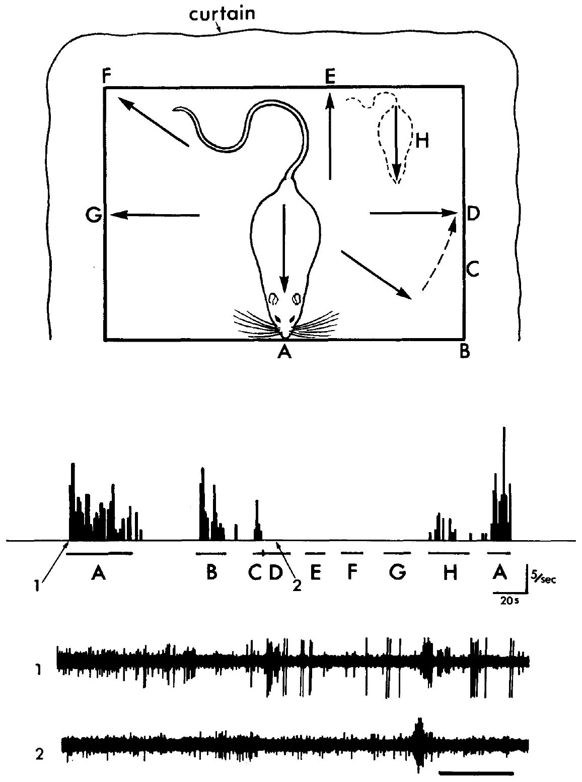
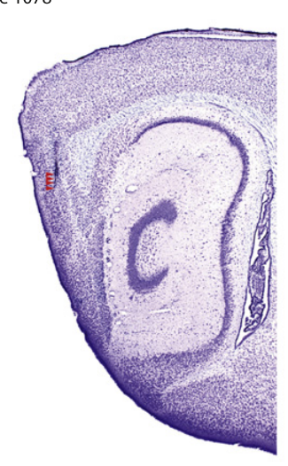
Spatial firing depends on an animal's surroundings
A place cell is a hippocampal neuron whose activity depends on the animal's location. O'Keefe and Dostrovsky recorded hippocampal units while rats moved on a 24 × 36 cm platform, testing whether neural firing could supply a spatial reference for behavior. The question was whether firing followed the animal's place rather than the task it was performing.
The clearest CA1 example also required a particular facing direction and a restraining tactile stimulus. Location was therefore one part of a combined response that included orientation and touch, and each element had to be present for the unit to fire strongly. Each condition was needed for the response, so the strong firing depended on the full combination.
The proposed cognitive map interpreted these responses as an internal representation of spatial relationships. The recordings established spatial coding in the hippocampus, which made a spatial reference for behavior a plausible function of the cells. The cognitive map was therefore an interpretation built on these spatial responses rather than a measured structure.
Giocomo et al. (2011), Fig. 3(A, upper histology). Mouse sagittal brain section and entorhinal recording location.
O'Keefe & Dostrovsky (1971), Fig. 1. Spatially dependent CA1 response to restraint.
O'Keefe & Dostrovsky (1971); Giocomo et al. (2011)
2
Notes:
A **place cell** is a neuron whose activity depends on the animal's location. O'Keefe and Dostrovsky recorded hippocampal units while rats moved on a 24 × 36 cm platform, testing whether neural firing could provide a spatial reference for behavior.
Their clearest CA1 example also required a particular facing direction and a restraining tactile stimulus. Location was therefore one component of a combined response, rather than the only variable controlling the cell.
The proposed **cognitive map**, an internal representation of spatial relationships, was an interpretation of these responses. The recordings supported spatial coding but did not establish a complete map or identify how it guides a route.
References:
O'Keefe J, Dostrovsky J (1971). The hippocampus as a spatial map. Preliminary evidence from unit activity in the freely-moving rat. Brain Research 34(1): 171–175. https://doi.org/10.1016/0006-8993(71)90358-1
Giocomo LM, Hussaini SA, Zheng F, Kandel ER, Moser MB, Moser EI (2011). Grid cells use HCN1 channels for spatial scaling. Cell 147(5): 1159–1170. https://doi.org/10.1016/j.cell.2011.08.051

Slide 3
Movable electrodes reveal activity during natural behavior
An extracellular recording measures voltage changes outside neurons when they fire action potentials. A lightweight skull-mounted microdrive let electrodes advance through the dorsal hippocampus while the recovered rat walked, groomed, ate or remained still, so the spikes were recorded during natural behavior. The electrode could be moved between recording sessions, so the same tissue was sampled over time.
Adjacent recording and reference electrodes fed a differential amplifier, which reduced shared muscle and movement artifacts. Because the recovered animal was not anesthetized, the preparation kept the behavior that anesthesia would remove, while the recording apparatus stayed attached to the animal. The preparation thus combined natural behavior with a stable recording from one animal.
The authors also tested sounds, moving visual stimuli, odors and touch. These tests separated spatially dependent responses from simple sensory responsiveness, so a unit's spatial tuning could be identified apart from its response to any single stimulus. Each stimulus type was tested in the same unit, so the spatial response could be judged against the others.
Giocomo et al. (2011), Fig. 3(A, upper histology). Mouse sagittal brain section and entorhinal recording location.
O'Keefe & Dostrovsky (1971), Fig. 1. Spatially dependent CA1 response to restraint.
O'Keefe & Dostrovsky (1971); Giocomo et al. (2011)
3
Notes:
An **extracellular recording** measures voltage changes outside neurons when they fire action potentials. A lightweight skull-mounted microdrive allowed electrodes to advance through the dorsal hippocampus while the recovered rat walked, groomed, ate, or remained still.
Adjacent recording and reference electrodes fed a differential amplifier, which reduced shared muscle and movement artifacts. The experimental preparation retained behavior that anesthesia would remove, while keeping the recording apparatus attached to the animal.
The authors also tested sounds, moving visual stimuli, odors, and touch. These comparisons distinguished spatially dependent responses from simple sensory responsiveness, although extracellular spikes alone could not identify a neuron's transmitter, dendritic structure, or synaptic inputs.
References:
O'Keefe J, Dostrovsky J (1971). The hippocampus as a spatial map. Preliminary evidence from unit activity in the freely-moving rat. Brain Research 34(1): 171–175. https://doi.org/10.1016/0006-8993(71)90358-1
Giocomo LM, Hussaini SA, Zheng F, Kandel ER, Moser MB, Moser EI (2011). Grid cells use HCN1 channels for spatial scaling. Cell 147(5): 1159–1170. https://doi.org/10.1016/j.cell.2011.08.051

Slide 4
Moving electrodes capture spikes during behavior
A microdrive moves the electrode in small steps, so a single unit can be followed as the rat changes behavior. Walking, grooming, eating and resting were all observed during the same recording session, so each spike train is paired with the behavior it accompanies.
Differential recording subtracts the signal shared by two nearby electrodes. That subtraction reduced artifacts from muscle and movement, which let the spikes of the hippocampal unit stand out during free movement. Both signals were recorded at one electrode site, so every spike is tied to the tissue it came from.
The authors also presented sounds, moving visual stimuli, odors and touch to the same units. Responses to these stimuli separated spatially dependent firing from ordinary sensory responsiveness. Each stimulus type was presented while the same unit was recorded, so the responses can be compared directly.
Giocomo et al. (2011), Fig. 3(A, upper histology). Mouse sagittal brain section and entorhinal recording location.
O'Keefe & Dostrovsky (1971), Fig. 1. Spatially dependent CA1 response to restraint.
O'Keefe & Dostrovsky (1971)
3a
Notes:
Movable electrodes capture spikes during behavior.
Recording.
The electrode advanced through the hippocampus.
The rat moved and rested freely.
Artifacts.
Shared muscle signals were subtracted.
Spikes stood out during movement.
Stimuli.
Sounds, visual, odor and touch stimuli were tested.
Spatial responses were separated from sensory ones.
Meaning.
Behavior and spikes are recorded together.
Spatial tuning is identified in free movement.
Explanation 1.
A microdrive moves the electrode in small steps, so a single unit can be followed as the rat changes behavior
Walking, grooming, eating and resting were all observed during the same recording session, so each spike train is paired with the behavior it accompanies.
Explanation 2.
Differential recording subtracts the signal shared by two nearby electrodes
That subtraction reduced artifacts from muscle and movement, which let the spikes of the hippocampal unit stand out during free movement. Both signals were recorded at one electrode site, so every spike is tied to the tissue it came from.
Explanation 3.
The authors also presented sounds, moving visual stimuli, odors and touch to the same units
Responses to these stimuli separated spatially dependent firing from ordinary sensory responsiveness. Each stimulus type was presented while the same unit was recorded, so the responses can be compared directly.
References:
O'Keefe J, Dostrovsky J (1971). The hippocampus as a spatial map. Preliminary evidence from unit activity in the freely-moving rat. Brain Research 34(1): 171–175. https://doi.org/10.1016/0006-8993(71)90358-1

Slide 5
Touch evokes firing only at preferred orientations
The recorded CA1 unit fired when the rat was restrained at positions A and B. A hand over the back supplied the tactile stimulus while the experimenter moved the animal around the platform and repeated the same manipulation at other positions, so position and touch were varied together. The unit's response was then examined at each of these locations under the same stimulation.
At position D, the same restraint produced a much weaker response than at A. At A, remaining still without restraint also failed to produce firing. Both the spatial configuration and the tactile input were therefore needed to evoke the strong response under these conditions. The strong response at A therefore required both the position and the tactile input at once.
A conjunctive response depends on a combination of variables. This cell's response was conjunctive, so it combined touch with the animal's position on the platform. Touch alone or position alone was insufficient to drive the strong response. The recorded firing reflected the combination of place and touch, which is the feature the experiment isolated.
Giocomo et al. (2011), Fig. 3(A, upper histology). Mouse sagittal brain section and entorhinal recording location.
O'Keefe & Dostrovsky (1971), Fig. 1. Spatially dependent CA1 response to restraint.
O'Keefe & Dostrovsky (1971); Giocomo et al. (2011)
4
Notes:
The recorded CA1 unit fired when the rat was restrained at positions A and B. A hand over the back supplied the tactile stimulus while the experimenter moved the animal around the platform and repeated the same manipulation at other positions.
At position D, the same restraint did not produce the strong response present at A. At A, remaining still without restraint also failed to produce firing. Both the spatial configuration and the tactile input were required under these conditions.
A **conjunctive response** depends on a combination of variables. This cell's response was conjunctive, so the finding cannot be reduced to either a touch detector or a pure position detector independent of sensory conditions.
References:
O'Keefe J, Dostrovsky J (1971). The hippocampus as a spatial map. Preliminary evidence from unit activity in the freely-moving rat. Brain Research 34(1): 171–175. https://doi.org/10.1016/0006-8993(71)90358-1
Giocomo LM, Hussaini SA, Zheng F, Kandel ER, Moser MB, Moser EI (2011). Grid cells use HCN1 channels for spatial scaling. Cell 147(5): 1159–1170. https://doi.org/10.1016/j.cell.2011.08.051

Slide 6
Position contributes beyond the direction of facing
O'Keefe and Dostrovsky translated the rat to position H while keeping an orientation related to the preferred orientation. The response became much smaller, so the unit's activity depended on more than facing direction. The response fell by a large proportion, which showed that the unit was tuned to the full configuration.
The procedure compared restraint at multiple positions and orientations, with intervals of immobility before and after restraint. These intervals isolated the sensory manipulation from the animal's movement between testing positions, which kept the sensory test separate from locomotion. Immobility intervals on each side of the restraint kept the sensory input separate from motor activity.
A neuron's spatial field is the set of locations associated with elevated firing under specified conditions. In this early experiment, the effective field included position, orientation and touch, so a firing field is defined together with the behavioral conditions used to measure it. Defining the field this way links the cell's firing to the exact conditions under which it was measured.
Giocomo et al. (2011), Fig. 3(A, upper histology). Mouse sagittal brain section and entorhinal recording location.
O'Keefe & Dostrovsky (1971), Fig. 1. Spatially dependent CA1 response to restraint.
O'Keefe & Dostrovsky (1971); Giocomo et al. (2011)
5
Notes:
O'Keefe and Dostrovsky translated the rat to position H while retaining an orientation related to the preferred orientation. The response became much smaller, indicating that facing direction alone did not account for the unit's activity.
The platform procedure compared restraint at multiple positions and orientations, with intervals of immobility before and after restraint. These intervals separated the sensory manipulation from the animal's movement between testing positions.
A neuron's **spatial field** is the set of locations associated with elevated firing under specified conditions. In this early experiment, the effective field included position, orientation, and touch. A firing field should therefore be defined together with the behavioral conditions used to measure it.
References:
O'Keefe J, Dostrovsky J (1971). The hippocampus as a spatial map. Preliminary evidence from unit activity in the freely-moving rat. Brain Research 34(1): 171–175. https://doi.org/10.1016/0006-8993(71)90358-1
Giocomo LM, Hussaini SA, Zheng F, Kandel ER, Moser MB, Moser EI (2011). Grid cells use HCN1 channels for spatial scaling. Cell 147(5): 1159–1170. https://doi.org/10.1016/j.cell.2011.08.051

Slide 7
Visual cues are necessary for the original CA1 example
Switching off the lights abolished the response of the featured CA1 unit. The spatially restricted tactile response therefore depended on visual information, even though the immediate stimulus that evoked firing was touch on the animal's back. The visual dependence was observed in the same unit that responded to touch, which made the link direct.
The authors moved striped cards past the animal and identified no restricted visual receptive field that explained the response. A receptive field is the region of sensory space within which a suitable stimulus alters a neuron's activity, and this response spread across the surrounding view. The authors used the striped cards to test whether one visual feature could explain the response.
The rat rotated between effective orientations, so a fixed retinal image was an unlikely explanation. These observations favored dependence on the surrounding visual configuration, which provided the positional information that drove the unit. The surrounding configuration offered a stable reference across the rat's changing orientation.
Giocomo et al. (2011), Fig. 3(A, upper histology). Mouse sagittal brain section and entorhinal recording location.
O'Keefe & Dostrovsky (1971), Fig. 1. Spatially dependent CA1 response to restraint.
O'Keefe & Dostrovsky (1971); Giocomo et al. (2011)
6
Notes:
Switching off the lights abolished the response of the featured CA1 unit. The spatially restricted tactile response depended on visual information, even though the immediate stimulus that evoked firing was touch on the animal's back.
The authors tested moving striped cards but could not identify a restricted visual receptive field that explained the response. A **receptive field** is the region of sensory space within which a suitable stimulus alters a neuron's activity.
The rat rotated between effective orientations, making a fixed retinal image an unlikely explanation. These observations favored dependence on the surrounding visual configuration, but the experiment did not isolate which particular landmarks supplied the relevant positional information.
References:
O'Keefe J, Dostrovsky J (1971). The hippocampus as a spatial map. Preliminary evidence from unit activity in the freely-moving rat. Brain Research 34(1): 171–175. https://doi.org/10.1016/0006-8993(71)90358-1
Giocomo LM, Hussaini SA, Zheng F, Kandel ER, Moser MB, Moser EI (2011). Grid cells use HCN1 channels for spatial scaling. Cell 147(5): 1159–1170. https://doi.org/10.1016/j.cell.2011.08.051

Slide 8
Light removal abolishes a touch-evoked response
Turning off the lights removed the response of the featured CA1 unit. The restricted tactile response therefore depended on visual information, even though touch on the animal's back was the stimulus that evoked the firing. The stimulus that evoked the firing was touch, which shows that a visual condition can gate a tactile response.
Moving striped cards produced no response that a small visual receptive field could explain. A receptive field is the region of sensory space in which a suitable stimulus changes a neuron's activity, and the result pointed to the wider surrounding view. The striped cards were moved through the visual field, so features across that whole field were tested.
The rat turned through several effective orientations, so a fixed retinal image is an unlikely explanation. The observations favored dependence on the surrounding visual configuration over any single landmark. The surrounding visual configuration offered a stable reference as the rat rotated through its orientations.
Giocomo et al. (2011), Fig. 3(A, upper histology). Mouse sagittal brain section and entorhinal recording location.
O'Keefe & Dostrovsky (1971), Fig. 1. Spatially dependent CA1 response to restraint.
O'Keefe & Dostrovsky (1971)
6a
Notes:
Light removal abolishes a touch-evoked response.
Darkness.
Lights were switched off.
The tactile response disappeared.
Receptive field.
No small visual field explained the response.
The surrounding view was implicated.
Orientation.
The rat rotated through effective orientations.
A fixed retinal image was unlikely.
Meaning.
Visual configuration shapes the response.
Touch alone was not sufficient.
Explanation 1.
Turning off the lights removed the response of the featured CA1 unit
The restricted tactile response therefore depended on visual information, even though touch on the animal's back was the stimulus that evoked the firing. The stimulus that evoked the firing was touch, which shows that a visual condition can gate a tactile response.
Explanation 2.
Moving striped cards produced no response that a small visual receptive field could explain
A receptive field is the region of sensory space in which a suitable stimulus changes a neuron's activity, and the result pointed to the wider surrounding view. The striped cards were moved through the visual field, so features across that whole field were tested.
Explanation 3.
The rat turned through several effective orientations, so a fixed retinal image is an unlikely explanation
The observations favored dependence on the surrounding visual configuration over any single landmark. The surrounding visual configuration offered a stable reference as the rat rotated through its orientations.
References:
O'Keefe J, Dostrovsky J (1971). The hippocampus as a spatial map. Preliminary evidence from unit activity in the freely-moving rat. Brain Research 34(1): 171–175. https://doi.org/10.1016/0006-8993(71)90358-1

Slide 9
Arousal changes the expression of spatial responses
A neighboring hippocampal unit responded to moving visual stimuli when the rat occupied a preferred orientation between G and A. At moderate arousal, stimulation elsewhere evoked no comparable response. The unit's response depended on both the location and the arousal state of the animal.
At higher arousal, weak responses became possible outside the preferred orientation, while the preferred response grew stronger. Arousal here refers to the animal's behavioral activation state, which changed how readily sensory input produced spikes. Higher arousal therefore changed the sensitivity of the cell to the same visual input.
The same sensory stimulus therefore produced different responses depending on spatial configuration and behavioral state. State dependence shapes which stimuli a spatially tuned unit can drive, and the response changes with the animal's activation level. The response changed with the animal's behavioral state while the stimulus itself stayed the same.
Giocomo et al. (2011), Fig. 3(A, upper histology). Mouse sagittal brain section and entorhinal recording location.
O'Keefe & Dostrovsky (1971), Fig. 1. Spatially dependent CA1 response to restraint.
O'Keefe & Dostrovsky (1971); Giocomo et al. (2011)
7
Notes:
A neighboring hippocampal unit responded to moving visual stimuli when the rat occupied a preferred orientation between G and A. At moderate arousal, stimulation elsewhere did not evoke a comparable response.
At higher arousal, weak responses became possible outside the preferred orientation, while the preferred response grew stronger. **Arousal** refers here to the animal's behavioral activation state, which altered how readily sensory input produced spikes.
The same sensory stimulus therefore had different effects depending on spatial configuration and state. The observations establish state dependence of the response, but they do not identify the neuromodulator or receptor responsible. Assigning the effect to a particular transmitter would require an additional intervention.
References:
O'Keefe J, Dostrovsky J (1971). The hippocampus as a spatial map. Preliminary evidence from unit activity in the freely-moving rat. Brain Research 34(1): 171–175. https://doi.org/10.1016/0006-8993(71)90358-1
Giocomo LM, Hussaini SA, Zheng F, Kandel ER, Moser MB, Moser EI (2011). Grid cells use HCN1 channels for spatial scaling. Cell 147(5): 1159–1170. https://doi.org/10.1016/j.cell.2011.08.051

Slide 10
Cue manipulations test alternative spatial explanations
The investigators rotated the platform to test explanations based on local odors or tactile markings. They also removed prominent sound sources and darkened or occluded parts of the visual environment while monitoring spatially restricted responses. Each manipulation targeted one class of cue, so each result identified its contribution to the orientation preference.
Removing a single cue often left the orientation preferences intact. More radical changes, including removing the surrounding curtain, disrupted some responses and induced sustained exploration, so a familiar environment behaved like a new one. The removal of the curtain changed the animal's exploration as well as the spatial responses.
The authors proposed that several cues provide interchangeable spatial information. One cue can compensate for another, so the spatial code survives the loss of any single landmark. Several cues could therefore carry the same spatial information, and the code depends on their combined presence.
Giocomo et al. (2011), Fig. 3(A, upper histology). Mouse sagittal brain section and entorhinal recording location.
O'Keefe & Dostrovsky (1971), Fig. 1. Spatially dependent CA1 response to restraint.
O'Keefe & Dostrovsky (1971); Giocomo et al. (2011)
8
Notes:
The investigators rotated the platform to challenge explanations based on local odors or tactile markings. They also removed prominent sound sources and darkened or occluded portions of the visual environment while monitoring spatially restricted responses.
Individual cue removals often failed to disrupt orientation preferences. More radical changes, including removing the surrounding curtain, disrupted some responses and induced sustained exploration, making a familiar environment behave like a new one.
The authors proposed that several cues might provide interchangeable spatial information. This **redundancy** means one cue can compensate for another, but it remained a hypothesis: unsuccessful removal of a single cue does not prove that the remaining cues have equal causal influence.
References:
O'Keefe J, Dostrovsky J (1971). The hippocampus as a spatial map. Preliminary evidence from unit activity in the freely-moving rat. Brain Research 34(1): 171–175. https://doi.org/10.1016/0006-8993(71)90358-1
Giocomo LM, Hussaini SA, Zheng F, Kandel ER, Moser MB, Moser EI (2011). Grid cells use HCN1 channels for spatial scaling. Cell 147(5): 1159–1170. https://doi.org/10.1016/j.cell.2011.08.051

Slide 11
The cognitive-map proposal exceeds the initial recordings
O'Keefe and Dostrovsky proposed that activation of spatially selective cells, combined with signals related to movement, could recruit cells representing subsequent orientations. In this model, neural activity anticipates the sensory input associated with movement. The model connects firing in one set of cells to the activity of the next set in the sequence.
The 1971 recordings established location-dependent responses. Prediction, route selection and explanations of lesion-induced behavioral deficits were theoretical extensions that the authors built on those responses. The 1971 study measured location-dependent responses directly, while the rest of the model was built on them.
A neural representation is a reliable relationship between activity and a variable, while a navigational mechanism also requires transformations that guide behavior. The initial evidence supplied the first, and circuit manipulations during spatial choice tasks are the means of testing the second. Circuit manipulations during spatial choice tasks would show whether these transformations occur.
Giocomo et al. (2011), Fig. 3(A, upper histology). Mouse sagittal brain section and entorhinal recording location.
O'Keefe & Dostrovsky (1971), Fig. 1. Spatially dependent CA1 response to restraint.
O'Keefe & Dostrovsky (1971); Giocomo et al. (2011)
9
Notes:
O'Keefe and Dostrovsky proposed that activation of spatially selective cells, combined with signals related to movement, could recruit cells representing subsequent orientations. This would allow neural activity to anticipate sensory input associated with movement.
The proposed internal wiring was not measured in the 1971 study. Recordings established location-dependent responses, whereas prediction, route selection, and explanation of lesion-induced behavioral deficits remained theoretical extensions of those observations.
A **neural representation** is a reliable relationship between activity and a variable; a navigational mechanism additionally requires transformations that guide behavior. The initial evidence supplied the former. Establishing the latter requires manipulations of the circuit during tasks that demand spatial choices.
References:
O'Keefe J, Dostrovsky J (1971). The hippocampus as a spatial map. Preliminary evidence from unit activity in the freely-moving rat. Brain Research 34(1): 171–175. https://doi.org/10.1016/0006-8993(71)90358-1
Giocomo LM, Hussaini SA, Zheng F, Kandel ER, Moser MB, Moser EI (2011). Grid cells use HCN1 channels for spatial scaling. Cell 147(5): 1159–1170. https://doi.org/10.1016/j.cell.2011.08.051

Slide 12
The cognitive map links firing to predicted input
O'Keefe and Dostrovsky proposed that spatially selective cells, together with movement signals, could recruit cells representing subsequent orientations. In this model the network anticipates the sensory input that movement brings. The model describes a sequence in which each population prepares the next orientation before the animal moves.
The 1971 recordings established location-dependent firing. Prediction, route selection and the explanation of lesion-induced deficits were extensions that the authors built on those recordings. Route selection and lesion effects were therefore predictions that depended on the recorded spatial responses.
A neural representation is a reliable link between activity and a variable. A navigational mechanism adds transformations that guide behavior, and testing that mechanism calls for circuit manipulations during tasks that require spatial choices. Tests of the model require recordings during tasks that place the animal at spatial decision points.
Giocomo et al. (2011), Fig. 3(A, upper histology). Mouse sagittal brain section and entorhinal recording location.
O'Keefe & Dostrovsky (1971), Fig. 1. Spatially dependent CA1 response to restraint.
O'Keefe & Dostrovsky (1971)
9a
Notes:
The cognitive map links firing to predicted input.
Proposal.
Selective cells recruit subsequent orientations.
Movement signals drive the recruitment.
Evidence.
Location-dependent firing was recorded.
Prediction was an extension of that firing.
Representation.
A representation links activity to a variable.
A mechanism adds behavior-guiding transformations.
Meaning.
The map is a testable circuit hypothesis.
Manipulations during spatial choice tasks test it.
Explanation 1.
O'Keefe and Dostrovsky proposed that spatially selective cells, together with movement signals, could recruit cells representing subsequent orientations
In this model the network anticipates the sensory input that movement brings. The model describes a sequence in which each population prepares the next orientation before the animal moves.
Explanation 2.
The 1971 recordings established location-dependent firing
Prediction, route selection and the explanation of lesion-induced deficits were extensions that the authors built on those recordings. Route selection and lesion effects were therefore predictions that depended on the recorded spatial responses.
Explanation 3.
A neural representation is a reliable link between activity and a variable
A navigational mechanism adds transformations that guide behavior, and testing that mechanism calls for circuit manipulations during tasks that require spatial choices. Tests of the model require recordings during tasks that place the animal at spatial decision points.
References:
O'Keefe J, Dostrovsky J (1971). The hippocampus as a spatial map. Preliminary evidence from unit activity in the freely-moving rat. Brain Research 34(1): 171–175. https://doi.org/10.1016/0006-8993(71)90358-1

Slide 13
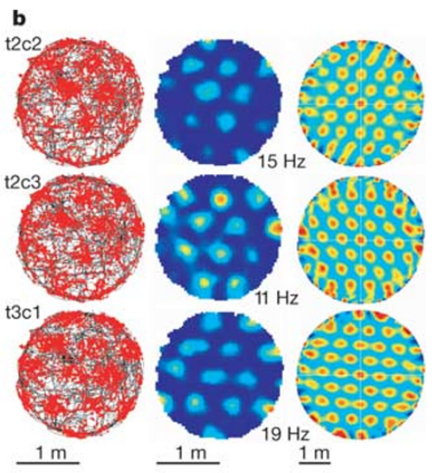
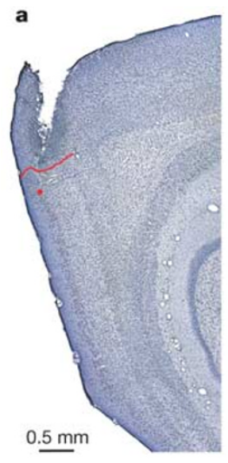
Entorhinal neurons fire at repeated spatial locations
A grid cell fires in multiple spatial fields arranged with approximately regular spacing. Hafting and colleagues recorded neurons in superficial dorsocaudal medial entorhinal cortex while rats explored a circular arena 2 m in diameter. Each cell's pattern repeats across the whole arena, so one cell covers many locations.
The larger arena exposed repeated fields that were difficult to recognize in smaller enclosures. Individual cells fired when the rat crossed separated locations distributed across the recording surface, rather than one confined region. Individual fields were distributed across the surface, so the repeated pattern was visible in each cell.
A firing-rate map relates activity to position after accounting for time spent at each location. The repeated fields establish a periodic spatial code, and the regular repetition is the property that defines the grid pattern across the arena. A periodic code of this kind repeats across space, which gives each location a characteristic set of active cells.
Hafting et al. (2005), Fig. 1(a). Nissl-stained rat entorhinal recording site.
Hafting et al. (2005), Fig. 1(b). Trajectories, rates and spatial autocorrelations.
Hafting et al. (2005)
10
Notes:
A **grid cell** fires in multiple spatial fields arranged with approximately regular spacing. Hafting and colleagues recorded neurons in superficial dorsocaudal medial entorhinal cortex while rats explored a circular arena 2 m in diameter.
The larger arena exposed repeated fields that were difficult to recognize in smaller enclosures. Individual cells fired when the rat crossed separated locations distributed across the recording surface, rather than only one confined region.
A firing-rate map relates activity to position after accounting for time spent at each location. The repeated fields establish a periodic spatial code. They do not mean that the cortex contains a physically drawn lattice or that each neuron independently specifies one unique place.
References:
Hafting T, Fyhn M, Molden S, Moser MB, Moser EI (2005). Microstructure of a spatial map in the entorhinal cortex. Nature 436(7052): 801–806. https://doi.org/10.1038/nature03721

Slide 14
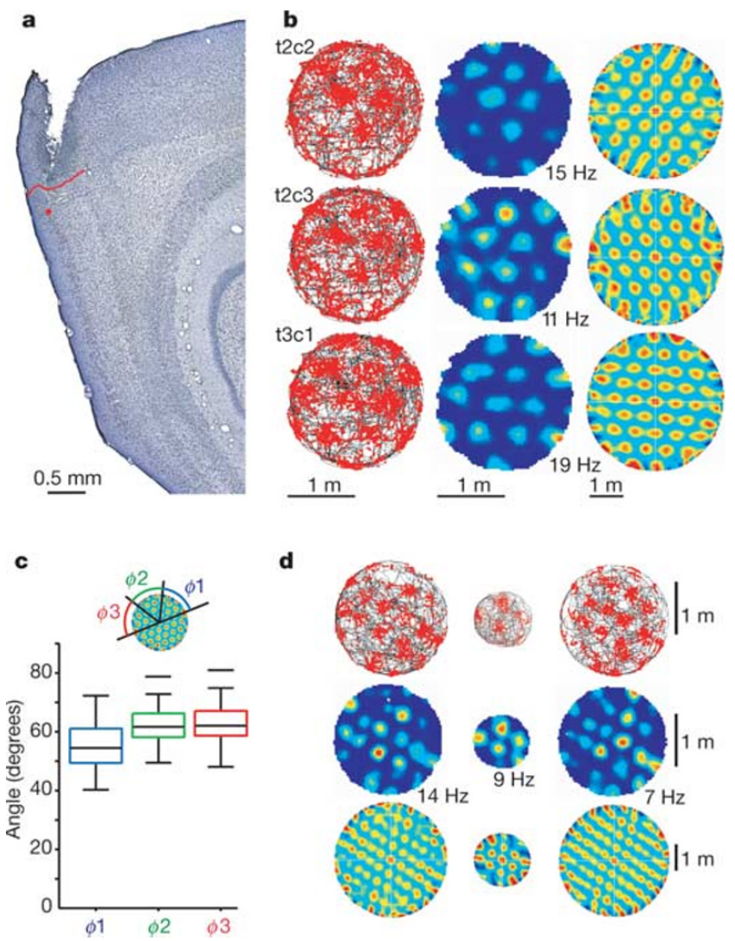
Histology locates the grid recordings in entorhinal cortex
Histology identifies tissue structure in thin stained brain sections. The recording location in Hafting and colleagues' example was in layer II of medial entorhinal cortex, near its border with postrhinal cortex. The layer assignment places the recording in the entorhinal circuit that projects to the hippocampus.
A Nissl stain highlights neuronal cell bodies and reveals cortical layers and regional boundaries. Electrode positions were reconstructed from their tracks and the recorded progression of the microdrive, linking physiological measurements to anatomical location. The reconstruction matched each electrode track to a recorded location in the tissue.
This reconstruction identifies an entorhinal recording rather than a hippocampal one. A spatial firing phenotype and an anatomical layer are measurable properties, and together they tie the grid pattern to a defined cortical layer. Anatomy and firing phenotype together define which entorhinal layer carried the recorded pattern.
Hafting et al. (2005), Fig. 1(a). Nissl-stained rat entorhinal recording site.
Hafting et al. (2005), Fig. 1(a–d). Recording site and repeated spatial firing.
Hafting et al. (2005)
11
Notes:
**Histology** identifies tissue structure in thin stained brain sections. The recording location in Hafting and colleagues' example was in layer II of medial entorhinal cortex, near its border with postrhinal cortex.
A Nissl stain highlights neuronal cell bodies and allows cortical layers and regional boundaries to be recognized. Electrode positions were reconstructed from their tracks and the recorded progression of the microdrive, linking physiological measurements to anatomical location.
This reconstruction distinguishes an entorhinal recording from a hippocampal recording. It does not determine the molecular identity of every recorded cell. A spatial firing phenotype and an anatomical layer are measurable properties, but neither alone identifies the full synaptic circuit generating that phenotype.
References:
Hafting T, Fyhn M, Molden S, Moser MB, Moser EI (2005). Microstructure of a spatial map in the entorhinal cortex. Nature 436(7052): 801–806. https://doi.org/10.1038/nature03721

Slide 15
Rate maps separate firing from uneven exploration
Rats spend uneven time at different points in an arena. A firing rate, measured in spikes per second or hertz, relates spike counts to the time available for spikes at each location. Spike counts are divided by the time spent at each location, which normalizes the map.
Hafting and colleagues compared the animal's trajectory with spike locations and the corresponding rate map. Repeated regions of elevated rate remained after the spatial distribution of occupancy was incorporated into the analysis. The repeated regions of high rate were recognizable after this normalization.
Occupancy correction keeps a frequently visited region from counting as a high-response field. Adequate exploration supplies the samples on which each location's rate depends, and a color-coded rate map shows measured activity across the arena. Each location's rate is an estimate whose reliability depends on the number of visits.
Hafting et al. (2005), Fig. 1(a). Nissl-stained rat entorhinal recording site.
Hafting et al. (2005), Fig. 1(b). Trajectories, rates and spatial autocorrelations.
Hafting et al. (2005)
12
Notes:
Rats do not spend equal time at every point in an arena. A **firing rate**, measured in spikes per second or hertz, relates spike counts to the time available for spikes at each location.
Hafting and colleagues compared the animal's trajectory with spike locations and the corresponding rate map. Repeated regions of elevated rate remained after the spatial distribution of occupancy was incorporated into the analysis.
The comparison prevents a frequently visited region from being treated automatically as a high-response field. It still depends on adequate exploration: poorly sampled locations provide limited evidence about firing. A color-coded rate map represents measured neuronal activity, rather than a direct image of anatomical connections between spatial fields.
References:
Hafting T, Fyhn M, Molden S, Moser MB, Moser EI (2005). Microstructure of a spatial map in the entorhinal cortex. Nature 436(7052): 801–806. https://doi.org/10.1038/nature03721

Slide 16
Occupancy correction sets the firing-rate scale
Hafting and colleagues recorded spikes while rats explored a circular arena, and the animals spent unequal time at each location. The firing rate at each location relates the spike count to the time the animal spent there. The analysis corrects for uneven exploration so that the rate at each location is a fair measure of firing.
Repeated regions of elevated rate remained after occupancy was built into the analysis. The repeated pattern therefore reflects where the cell fires, not where the rat lingers. The repeated elevated regions after this correction show that the pattern reflects the cell's firing.
Locations sampled poorly give little information about firing, so the reliability of each rate value depends on how thoroughly the arena was explored. A color map of these rates displays measured activity across the whole arena. The correction is applied to each location separately, so every part of the arena contributes its own rate.
Hafting et al. (2005), Fig. 1(a). Nissl-stained rat entorhinal recording site.
Hafting et al. (2005), Fig. 1(b). Trajectories, rates and spatial autocorrelations.
Hafting et al. (2005)
12a
Notes:
Occupancy correction sets the firing-rate scale.
Occupancy.
Rats spent unequal time at locations.
Rates were scaled by the time available.
Result.
Repeated elevated regions remained.
The pattern reflects firing, not lingering.
Sampling.
Poorly sampled locations are uncertain.
Exploration sets reliability.
Meaning.
Rate maps show measured activity.
The map is a record of spiking.
Explanation 1.
Hafting and colleagues recorded spikes while rats explored a circular arena, and the animals spent unequal time at each location
The firing rate at each location relates the spike count to the time the animal spent there. The analysis corrects for uneven exploration so that the rate at each location is a fair measure of firing.
Explanation 2.
Repeated regions of elevated rate remained after occupancy was built into the analysis
The repeated pattern therefore reflects where the cell fires, not where the rat lingers. The repeated elevated regions after this correction show that the pattern reflects the cell's firing.
Explanation 3.
Locations sampled poorly give little information about firing, so the reliability of each rate value depends on how thoroughly the arena was explored
A color map of these rates displays measured activity across the whole arena. The correction is applied to each location separately, so every part of the arena contributes its own rate.
References:
Hafting T, Fyhn M, Molden S, Moser MB, Moser EI (2005). Microstructure of a spatial map in the entorhinal cortex. Nature 436(7052): 801–806. https://doi.org/10.1038/nature03721

Slide 17
Spatial autocorrelation measures repeated grid structure
Spatial autocorrelation compares a rate map with shifted versions of itself. Similarity rises when the displacement aligns one set of firing fields with another, which exposes repetition that a single trajectory may hide. The autocorrelation turns a rate map into a measure of its own repetition.
The central autocorrelation peak represents alignment without displacement. Six nearby peaks surrounded it, with directions separated by about 60°, an arrangement consistent with firing locations at the vertices of an equilateral triangular lattice. The six surrounding peaks identify the lattice directions of the pattern.
A temporal autocorrelation is a different measure: it compares the timing of spikes at different lags. The spatial measure reveals the regularity of the spatial pattern and identifies the lattice geometry, while leaving the circuit that produces the pattern to other experiments. The lattice geometry is therefore visible in the spatial pattern itself, independent of the circuit.
Hafting et al. (2005), Fig. 1(a). Nissl-stained rat entorhinal recording site.
Hafting et al. (2005), Fig. 1(b). Trajectories, rates and spatial autocorrelations.
Hafting et al. (2005)
13
Notes:
**Spatial autocorrelation** compares a rate map with shifted versions of itself. Similarity becomes high when the displacement aligns one set of firing fields with another, exposing repetition that may be less apparent from a single trajectory.
The central autocorrelation peak represents alignment without displacement. Six nearby peaks surrounded it, with directions separated by approximately 60°. That arrangement was consistent with firing locations at the vertices of an equilateral triangular lattice.
The analysis establishes regularity of the spatial pattern, rather than a mechanism that creates it. An autocorrelation map is also distinct from a temporal autocorrelation: the former compares spatial displacements, while the latter compares the timing of spikes.
References:
Hafting T, Fyhn M, Molden S, Moser MB, Moser EI (2005). Microstructure of a spatial map in the entorhinal cortex. Nature 436(7052): 801–806. https://doi.org/10.1038/nature03721

Slide 18
Grid spacing specifies a distance between repeated fields
Grid spacing is the distance between neighboring repeated firing locations. Hafting and colleagues estimated spacing from the distances between the central autocorrelation peak and its nearest surrounding peaks. The spacing estimate uses the distances from the center to the nearest surrounding peaks.
Across the reported cells, spacing ranged from 39 to 73 cm. Within a cell, similar distances in several directions and an angular separation of about 60° supported a regular triangular pattern across the arena. Within each cell, the spacing in several directions matched the triangular pattern.
Spacing describes the spatial scale of a neuron's code, and cells with different spacing can represent the same room at different scales. The original observations also raised whether those scales vary continuously or fall into discrete functional modules. Different cells therefore carry different spatial scales across the same arena.
Hafting et al. (2005), Fig. 1(a). Nissl-stained rat entorhinal recording site.
Hafting et al. (2005), Fig. 1(b). Trajectories, rates and spatial autocorrelations.
Hafting et al. (2005)
14
Notes:
**Grid spacing** is the distance between neighboring repeated firing locations. Hafting and colleagues estimated spacing from the distances between the central autocorrelation peak and its nearest surrounding peaks.
Across the reported cells, spacing ranged from 39 to 73 cm. Within a cell, similar distances in several directions and approximately 60° angular separation supported a regular triangular pattern across the arena.
Spacing describes the spatial scale of a neuron's code, not the distance between neurons in brain tissue. Cells with different spacing can represent the same physical environment at different scales. The original observations did not establish whether those scales were selected continuously or organized into discrete functional modules.
References:
Hafting T, Fyhn M, Molden S, Moser MB, Moser EI (2005). Microstructure of a spatial map in the entorhinal cortex. Nature 436(7052): 801–806. https://doi.org/10.1038/nature03721

Slide 19
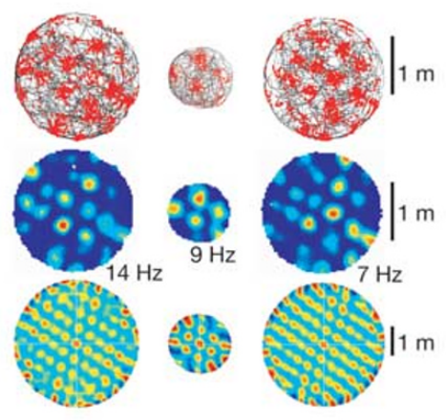
Arena expansion adds fields without matching the boundary
Hafting and colleagues recorded cells as animals moved between a large and a smaller circular enclosure and returned to the large enclosure. The repeated triangular organization remained recognizable across the changes in available surface. The enlargement changes the number of fields available in a single trial.
The expanded arena contained more activity nodes, while their density remained similar. The pattern was therefore not a small fixed collection of fields stretched to match the enclosing walls. The fields in the expanded arena kept their size and separation.
The result supports a spatially repeated code that extends across recording areas. The authors discussed grids of potentially unlimited extent, and each arena size sets how much of the pattern a recording can sample. Each enclosure therefore reveals a different portion of one underlying repeated pattern.
Hafting et al. (2005), Fig. 1(a). Nissl-stained rat entorhinal recording site.
Hafting et al. (2005), Fig. 1(d). Grid fields in large and small arenas.
Hafting et al. (2005)
15
Notes:
Hafting and colleagues recorded cells as animals moved between a large and a smaller circular enclosure and returned to the large enclosure. The repeated triangular organization remained recognizable across the changes in available surface.
The expanded arena contained more activity nodes, while their density remained similar. The pattern therefore was not simply a small fixed collection of fields stretched to match the enclosing walls.
The result supports a spatially repeated code that can extend across different recording areas. The authors discussed potentially unlimited grids, but finite experimental arenas cannot establish infinite extent. Boundaries and available sampling still limit which portions of a cell's spatial pattern can be observed.
References:
Hafting T, Fyhn M, Molden S, Moser MB, Moser EI (2005). Microstructure of a spatial map in the entorhinal cortex. Nature 436(7052): 801–806. https://doi.org/10.1038/nature03721

Slide 20
Repeated fields survive a change of arena size
Hafting and colleagues moved animals between a large and a smaller circular enclosure and then back to the large one. The triangular organization stayed recognizable across the change in available surface. Both enclosures were circular, so the same geometry was used for the expansion and the return.
The larger arena contained more activity nodes at a similar density. The pattern was therefore a repeated code, not a small set of fields stretched to fit the walls. The expanded arena held the same density of activity nodes, which means the pattern grew with the surface.
The authors discussed grids of potentially unlimited extent, and each arena size sets how much of the pattern a recording can sample. The periodic code is a property of the cell rather than of the enclosure that holds it. The periodic code is therefore a property that extends across the surface, not one fixed to a single box.
Hafting et al. (2005), Fig. 1(a). Nissl-stained rat entorhinal recording site.
Hafting et al. (2005), Fig. 1(d). Grid fields in large and small arenas.
Hafting et al. (2005)
15a
Notes:
Repeated fields survive a change of arena size.
Arenas.
Animals moved between two circular enclosures.
The large enclosure was revisited.
Pattern.
The triangular organization stayed recognizable.
Node density stayed similar.
Extent.
Grids could extend beyond one arena.
Arena size sets how much is sampled.
Meaning.
The periodic code belongs to the cell.
Enclosures only reveal part of it.
Explanation 1.
Hafting and colleagues moved animals between a large and a smaller circular enclosure and then back to the large one
The triangular organization stayed recognizable across the change in available surface. Both enclosures were circular, so the same geometry was used for the expansion and the return.
Explanation 2.
The larger arena contained more activity nodes at a similar density
The pattern was therefore a repeated code, not a small set of fields stretched to fit the walls. The expanded arena held the same density of activity nodes, which means the pattern grew with the surface.
Explanation 3.
The authors discussed grids of potentially unlimited extent, and each arena size sets how much of the pattern a recording can sample
The periodic code is a property of the cell rather than of the enclosure that holds it. The periodic code is therefore a property that extends across the surface, not one fixed to a single box.
References:
Hafting T, Fyhn M, Molden S, Moser MB, Moser EI (2005). Microstructure of a spatial map in the entorhinal cortex. Nature 436(7052): 801–806. https://doi.org/10.1038/nature03721

Slide 21
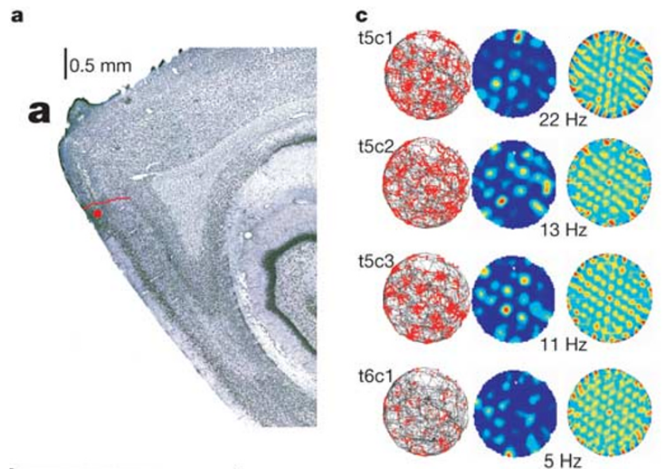
Nearby grid cells share orientation and spacing
Simultaneously recorded grid cells near the same electrode location had similar spacing and orientation. Orientation is the angle of the lattice relative to a reference direction in the recording environment. Neighboring cells recorded at once carry a shared geometry in their rate maps.
Their rate maps contained repeated fields with a common geometry, even when the locations of individual fields differed. A tetrode, a bundle of four recording wires, helps separate neurons by comparing spike amplitudes across channels. The shared geometry appeared even when the individual field positions were offset.
Shared metric properties point to coordination among nearby cells. Common input and local interactions are both candidate explanations for the coordinated geometry, and the recordings capture that shared geometry directly. Coordinated geometry among neighbors is a measurable feature of the grid population.
Hafting et al. (2005), Fig. 1(a). Nissl-stained rat entorhinal recording site.
Hafting et al. (2005), Fig. 2(a,c). Rat recording site and dorsal grid fields.
Hafting et al. (2005)
16
Notes:
Simultaneously recorded grid cells near the same electrode location had similar spacing and orientation. **Orientation** is the angle of the lattice relative to a reference direction in the recording environment.
Their rate maps contained repeated fields with a common geometry, even when the locations of individual fields differed. A **tetrode**, a bundle of four recording wires, helps separate neurons by comparing the amplitudes of their spikes on multiple channels.
Shared metric properties support coordination among nearby cells. They do not establish direct synaptic connections between every simultaneously recorded pair. Common input and local interactions are both possible explanations for coordinated geometry, and extracellular recordings alone do not distinguish them.
References:
Hafting T, Fyhn M, Molden S, Moser MB, Moser EI (2005). Microstructure of a spatial map in the entorhinal cortex. Nature 436(7052): 801–806. https://doi.org/10.1038/nature03721

Slide 22
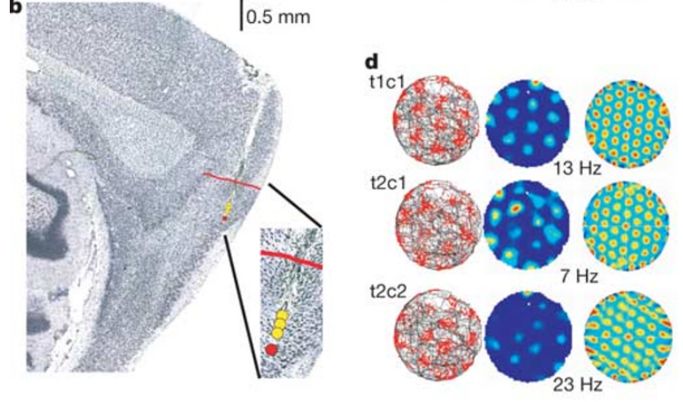
Ventral recording sites have wider grid spacing
Dorsal and ventral describe positions along the anatomical axis used to compare recording sites. In one rat, a site near the dorsal entorhinal border had denser grid spacing than a site 560 µm deeper. Each recording site was located on the reconstructed electrode track in the tissue.
Reported spacing was 39.1–43.0 cm at the dorsal location and 48.1–52.2 cm at the more ventral location. Comparing sites within one animal kept explanations based on differences between animals or environments from driving the result. Both sites were in the same animal, so the anatomical difference was measured within one brain.
The finding links anatomical position to the spatial scale of firing. The recordings sampled different cells at different positions, which revealed an organized relationship across the tissue that holds across the sampled depth. The measured spacing differences follow the depth of the recording site.
Hafting et al. (2005), Fig. 1(a). Nissl-stained rat entorhinal recording site.
Hafting et al. (2005), Fig. 2(b,d). Ventral recording site and grid fields.
Hafting et al. (2005)
17
Notes:
**Dorsal** and **ventral** describe positions along the anatomical axis used to compare recording sites. In the same rat, one site near the dorsal entorhinal border had denser grid spacing than a site 560 µm deeper.
Reported spacing was 39.1–43.0 cm at the dorsal location and 48.1–52.2 cm at the more ventral location. Comparing sites within one animal reduced explanations based entirely on differences between animals or their environments.
The finding links anatomical position to the spatial scale of firing. It does not mean that the same neuron changed scale solely because an electrode moved. The recordings sampled different cells at different positions, revealing an organized relationship across the tissue.
References:
Hafting T, Fyhn M, Molden S, Moser MB, Moser EI (2005). Microstructure of a spatial map in the entorhinal cortex. Nature 436(7052): 801–806. https://doi.org/10.1038/nature03721

Slide 23
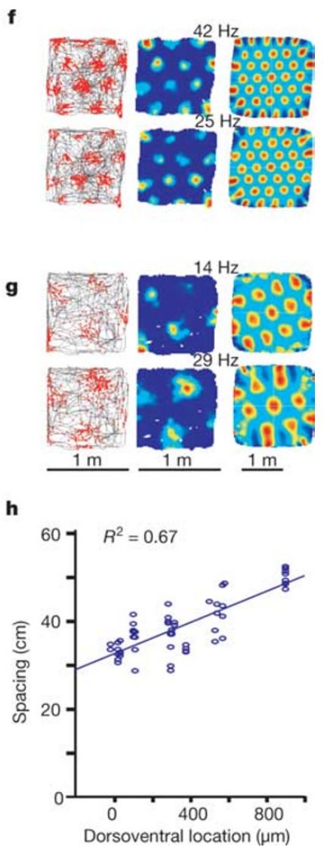
Grid field size increases with the spatial scale
A firing field is a region where a cell's rate exceeds the surrounding background under the tested conditions. Hafting and colleagues measured field size from the central peak of the spatial autocorrelation. The field boundary is set by the rate threshold chosen for the analysis.
More ventral recording positions were associated with both greater spacing and larger individual fields. Spacing concerns the separation between fields, whereas field size concerns the extent of each field. Larger fields accompanied the greater spacing at the more ventral sites.
Their joint increase produces a coarser spatial pattern, not merely a shift of unchanged fields farther apart. Field size depends on the analysis threshold, so it measures an activity region rather than an anatomical boundary visible in the tissue. The pattern becomes coarser as both the spacing and the size of the fields increase.
Hafting et al. (2005), Fig. 1(a). Nissl-stained rat entorhinal recording site.
Hafting et al. (2005), Fig. 2(f–h). Recording depth and spatial scale.
Hafting et al. (2005)
18
Notes:
A **firing field** is a region where a cell's rate exceeds the surrounding background under the tested conditions. Hafting and colleagues measured field size from the central peak of the spatial autocorrelation.
More ventral recording positions were associated with both greater spacing and larger individual fields. These are related but distinct properties: spacing concerns separation between fields, whereas field size concerns the extent of each field.
Their joint increase produces a coarser spatial pattern, rather than merely moving unchanged fields farther apart. The measurements depend on the stated analysis threshold. Field size is therefore an operational measurement of an activity pattern, not an anatomical boundary visible in the entorhinal tissue.
References:
Hafting T, Fyhn M, Molden S, Moser MB, Moser EI (2005). Microstructure of a spatial map in the entorhinal cortex. Nature 436(7052): 801–806. https://doi.org/10.1038/nature03721

Slide 24
Field size grows with the spatial scale
A firing field is a region where a cell's rate exceeds its surrounding background under the tested conditions. Hafting and colleagues measured field size from the central peak of the spatial autocorrelation. The field boundary is set by the analysis threshold, which defines the region of elevated rate.
Ventral positions showed greater spacing and larger fields together. The two properties are related but separate: spacing describes the gap between fields, and field size describes the extent of each one. The two properties were measured from the same autocorrelation maps, so their values can be compared cell by cell.
Joint growth of spacing and field size produces a coarser pattern, not a set of unchanged fields moved farther apart. Field size depends on the analysis threshold, so it measures an activity region rather than a visible anatomical boundary. The coarser pattern at the ventral sites contains larger fields that are spaced further apart.
Hafting et al. (2005), Fig. 1(a). Nissl-stained rat entorhinal recording site.
Hafting et al. (2005), Fig. 2(f–h). Recording depth and spatial scale.
Hafting et al. (2005)
18a
Notes:
Field size grows with the spatial scale.
Field.
A firing field exceeds background rate.
Field size came from the autocorrelation peak.
Pattern.
Ventral sites had larger spacing and fields.
The two properties are related.
Growth.
Spacing and field size increase together.
The pattern becomes coarser.
Meaning.
Field size is an operational measure.
It depends on the threshold.
Explanation 1.
A firing field is a region where a cell's rate exceeds its surrounding background under the tested conditions
Hafting and colleagues measured field size from the central peak of the spatial autocorrelation. The field boundary is set by the analysis threshold, which defines the region of elevated rate.
Explanation 2.
Ventral positions showed greater spacing and larger fields together
The two properties are related but separate: spacing describes the gap between fields, and field size describes the extent of each one. The two properties were measured from the same autocorrelation maps, so their values can be compared cell by cell.
Explanation 3.
Joint growth of spacing and field size produces a coarser pattern, not a set of unchanged fields moved farther apart
Field size depends on the analysis threshold, so it measures an activity region rather than a visible anatomical boundary. The coarser pattern at the ventral sites contains larger fields that are spaced further apart.
References:
Hafting T, Fyhn M, Molden S, Moser MB, Moser EI (2005). Microstructure of a spatial map in the entorhinal cortex. Nature 436(7052): 801–806. https://doi.org/10.1038/nature03721

Slide 25
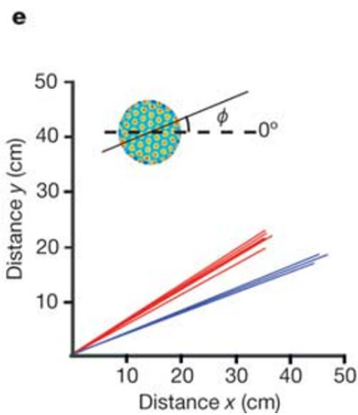
Grid orientation is distinct from the scale gradient
The angle of a grid can differ between recording locations even when nearby cells at each location share similar orientation. Hafting and colleagues defined that angle relative to a camera-based reference direction. The angle is measured from a fixed direction in the room.
Spacing and field size increased toward ventral locations, but orientation followed no such dorsal-to-ventral pattern. Spatial scale and directional alignment are therefore separate properties of the code. The difference in orientation appeared between sites without a matching change in spacing.
A change in angle rotates a lattice while leaving the distance between its fields intact. A change in spacing alters the metric scale, and separating these variables keeps a shift in directional reference from being mistaken for a change in spatial resolution. Each property therefore carries its own information about the code.
Hafting et al. (2005), Fig. 1(a). Nissl-stained rat entorhinal recording site.
Hafting et al. (2005), Fig. 2(e). Grid spacing and orientation at two sites.
Hafting et al. (2005)
19
Notes:
The angle of a grid can differ between recording locations even when nearby cells at each location share similar orientation. Hafting and colleagues defined that angle relative to a camera-based reference direction.
Spacing and field size increased toward ventral locations, but orientation did not exhibit the same systematic dorsal-to-ventral relationship. Spatial scale and directional alignment therefore must be treated as separate properties of the code.
A change in angle rotates a lattice without necessarily changing the distance between its fields. A change in spacing alters the metric scale without necessarily rotating it. Separating these variables prevents a shift in directional reference from being mistaken for a change in spatial resolution.
References:
Hafting T, Fyhn M, Molden S, Moser MB, Moser EI (2005). Microstructure of a spatial map in the entorhinal cortex. Nature 436(7052): 801–806. https://doi.org/10.1038/nature03721

Slide 26
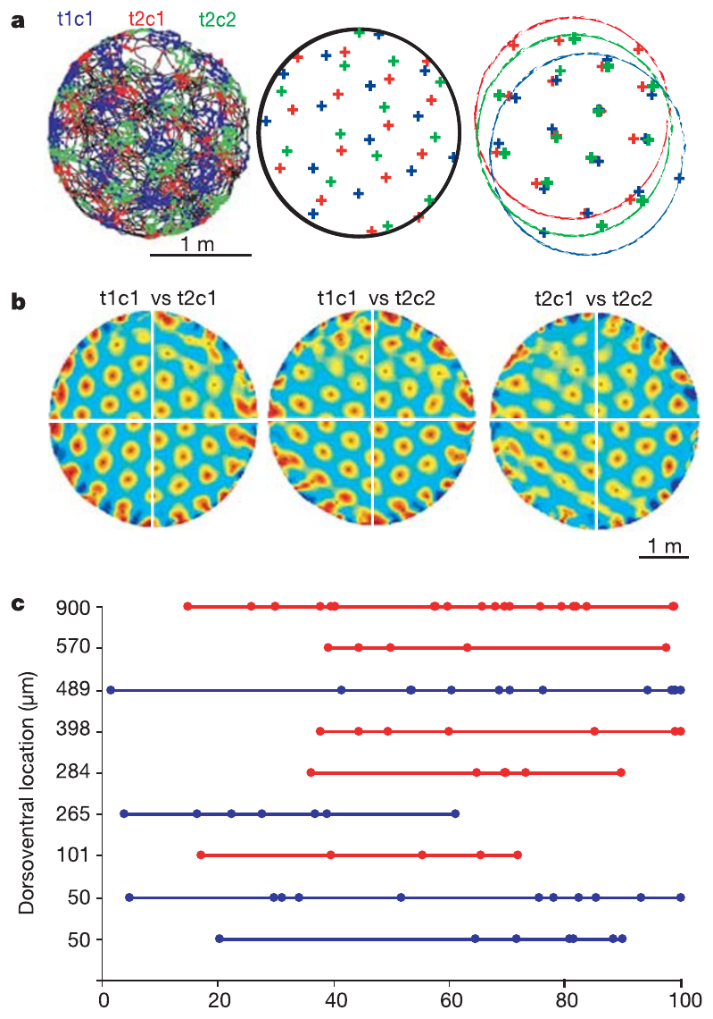
Grid phase differs among neighboring neurons
Spatial phase describes where the vertices of a grid lie relative to a reference location. Nearby neurons can share spacing and orientation while placing their elevated firing fields at different positions. Two cells with the same spacing and orientation can still be offset in their field placement.
Hafting and colleagues compared simultaneously recorded rate maps and found displaced versions of similar lattices. Superimposing the patterns after a spatial shift brought their vertices into closer alignment. The displaced lattices matched once the spatial shift was applied.
Different phases let neighboring cells become active at different positions, so together they cover more of the environment than one cell could. Phase here is a spatial displacement, a different measurement from the timing of a spike relative to an oscillation. Phase differences distribute the active fields across the environment.
Hafting et al. (2005), Fig. 1(a). Nissl-stained rat entorhinal recording site.
Hafting et al. (2005), Fig. 3(a–c). Spatial phases of neighboring grid cells.
Hafting et al. (2005)
20
Notes:
**Spatial phase** describes where the vertices of a grid lie relative to a reference location. Nearby neurons can share spacing and orientation while placing their elevated firing fields at different positions.
Hafting and colleagues compared simultaneously recorded rate maps and found displaced versions of similar lattices. Superimposing the patterns after a spatial shift brought their vertices into closer alignment.
Different phases allow neighboring cells to become active at different positions, collectively covering more of the environment than a single cell. Phase is a spatial displacement here, not the timing of a spike relative to an oscillation. These two uses of the word refer to different measurements.
References:
Hafting T, Fyhn M, Molden S, Moser MB, Moser EI (2005). Microstructure of a spatial map in the entorhinal cortex. Nature 436(7052): 801–806. https://doi.org/10.1038/nature03721

Slide 27
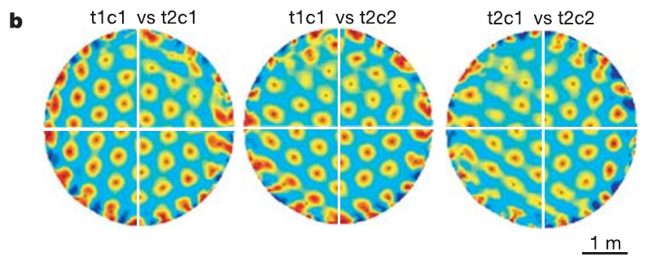
Cross-correlation compares the phase of two cells
Spatial cross-correlation compares the rate maps of two different neurons as one map is shifted relative to the other. Peaks indicate displacements that bring their firing patterns into alignment. The peak position reports the offset between the two firing patterns.
For neighboring grid cells, the cross-correlation kept a repeated arrangement but usually placed its nearest peak away from the origin. That offset quantifies a difference in spatial phase despite shared spacing and orientation. The offset is a measure of phase, computed directly from the two rate maps.
Cells at different recording locations can have different scales and orientations, which produces less sharply aligned cross-correlations. The measure captures the similarity of two spatial codes, and a correlated pattern can arise from common inputs without a direct synapse between the recorded cells. Such a measure is useful for describing how similar codes coexist in one population.
Hafting et al. (2005), Fig. 1(a). Nissl-stained rat entorhinal recording site.
Hafting et al. (2005), Fig. 3(b). Spatial cross-correlations of neighboring cells.
Hafting et al. (2005)
21
Notes:
**Spatial cross-correlation** compares the rate maps of two different neurons as one map is shifted relative to the other. Peaks indicate displacements that bring their firing patterns into alignment.
For neighboring grid cells, the cross-correlation retained a repeated arrangement but commonly placed its nearest peak away from the origin. That offset quantified a difference in spatial phase despite shared spacing and orientation.
Cells at different recording locations could have different scales and orientations, producing less sharply aligned cross-correlations. The comparison measures similarity of spatial codes, not communication between the neurons. A correlated pattern can arise through common inputs without a direct synapse between the recorded cells.
References:
Hafting T, Fyhn M, Molden S, Moser MB, Moser EI (2005). Microstructure of a spatial map in the entorhinal cortex. Nature 436(7052): 801–806. https://doi.org/10.1038/nature03721

Slide 28
Cross-correlation reveals a phase offset
Spatial cross-correlation compares two neurons' rate maps as one map slides across the other. A peak away from the origin marks the displacement that aligns the two firing patterns. Each shift of one map relative to the other produces a value, and the peaks identify the best alignments.
Neighboring grid cells shared spacing and orientation, yet their nearest peaks were offset from the origin. That offset measures the difference in spatial phase between the two cells. The peak offset is a quantitative value for phase, computed from the two rate maps in the same units.
Cells at different recording sites have different scales and orientations, so their cross-correlations are less sharply aligned. Shared inputs can produce a correlated pattern without any direct synapse between the recorded cells. The measure is useful because it reports the phase relation between two cells without needing a physical lattice.
Hafting et al. (2005), Fig. 1(a). Nissl-stained rat entorhinal recording site.
Hafting et al. (2005), Fig. 3(b). Spatial cross-correlations of neighboring cells.
Hafting et al. (2005)
21a
Notes:
Cross-correlation reveals a phase offset.
Method.
One rate map slides across another.
Peaks mark aligning displacements.
Offset.
Neighbors share spacing and orientation.
Their peaks are displaced from the origin.
Sites.
Distant cells differ in scale.
Alignment is sharper for nearby cells.
Meaning.
Phase is measured as an offset.
Shared inputs can produce correlation.
Explanation 1.
Spatial cross-correlation compares two neurons' rate maps as one map slides across the other
A peak away from the origin marks the displacement that aligns the two firing patterns. Each shift of one map relative to the other produces a value, and the peaks identify the best alignments.
Explanation 2.
Neighboring grid cells shared spacing and orientation, yet their nearest peaks were offset from the origin
That offset measures the difference in spatial phase between the two cells. The peak offset is a quantitative value for phase, computed from the two rate maps in the same units.
Explanation 3.
Cells at different recording sites have different scales and orientations, so their cross-correlations are less sharply aligned
Shared inputs can produce a correlated pattern without any direct synapse between the recorded cells. The measure is useful because it reports the phase relation between two cells without needing a physical lattice.
References:
Hafting T, Fyhn M, Molden S, Moser MB, Moser EI (2005). Microstructure of a spatial map in the entorhinal cortex. Nature 436(7052): 801–806. https://doi.org/10.1038/nature03721

Slide 29
Different phases distribute activity across the arena
A grid cell's periodic firing leaves locations where that particular cell is relatively inactive. Neighboring cells with different spatial phases place their fields in other regions while retaining similar metric properties. The periodic structure of each cell leaves gaps that other cells fill.
The recorded population covered the arena collectively, because field locations differed across cells. The observed phase differences spread across the available range rather than clustering around a single common alignment. The field positions cover the arena through the combined activity of the population.
Population coverage supports a code for location built from combinations of active neurons. Because periodic activity repeats, additional scales, starting-position information or other inputs can resolve the ambiguity that repetition creates. The combined activity therefore identifies a location through its pattern across cells.
Hafting et al. (2005), Fig. 1(a). Nissl-stained rat entorhinal recording site.
Hafting et al. (2005), Fig. 3(a–c). Spatial phases of neighboring grid cells.
Hafting et al. (2005)
22
Notes:
A grid cell's periodic firing leaves locations where that particular cell is relatively inactive. Neighboring cells with different spatial phases place their fields in other regions while retaining similar metric properties.
The recorded population collectively covered the arena because field locations differed across cells. The observed phase differences were distributed across the available range rather than restricted to a single common alignment.
Population coverage supports a code for location using combinations of active neurons. It does not establish that every location has a unique code in an arbitrarily large environment: periodic activity can repeat. Additional scales, starting-position information, or other inputs may be required to resolve such ambiguity.
References:
Hafting T, Fyhn M, Molden S, Moser MB, Moser EI (2005). Microstructure of a spatial map in the entorhinal cortex. Nature 436(7052): 801–806. https://doi.org/10.1038/nature03721

Slide 30
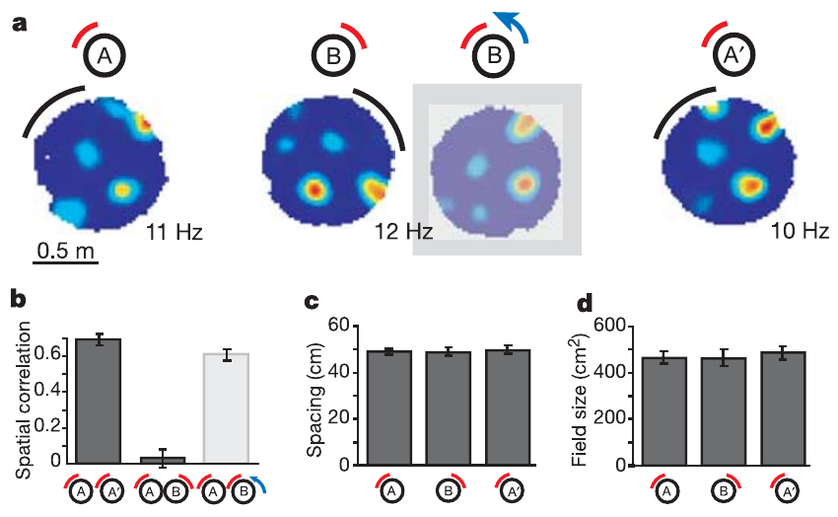
Landmark rotation rotates the grid's reference frame
An external landmark is an environmental feature that can supply a stable spatial reference. Hafting and colleagues rotated a cue card by 90° and compared the grid before, during and after the manipulation. The cue card was moved and the grid's alignment was recorded at each stage.
Grid orientation changed with the cue, while the periodic organization was retained. Returning the card toward its original position restored the corresponding alignment, which shows that a visible feature controls the grid's directional reference. The grid rotated with the card, and its spacing was unchanged.
The result distinguishes the existence of periodic firing from its alignment to a particular room. The same lattice keeps its geometry while external cues determine how it is oriented in the environment, so vision sets orientation rather than periodicity. External landmarks set the directional reference of a lattice that is generated internally.
Hafting et al. (2005), Fig. 1(a). Nissl-stained rat entorhinal recording site.
Hafting et al. (2005), Fig. 4(a–d). Grid alignment during cue-card rotation.
Hafting et al. (2005)
23
Notes:
An **external landmark** is an environmental feature that can supply a stable spatial reference. Hafting and colleagues rotated a cue card by 90° and compared the grid before, during, and after the manipulation.
Grid orientation changed with the cue, while the periodic organization was retained. Returning the card toward its original position restored the corresponding alignment, supporting control of the grid's directional reference by a visible environmental feature.
The result distinguishes the existence of periodic firing from its alignment to a particular room. It does not establish that vision generates the periodicity itself. The same lattice can retain its geometry while external cues determine how that lattice is oriented in the environment.
References:
Hafting T, Fyhn M, Molden S, Moser MB, Moser EI (2005). Microstructure of a spatial map in the entorhinal cortex. Nature 436(7052): 801–806. https://doi.org/10.1038/nature03721

Slide 31
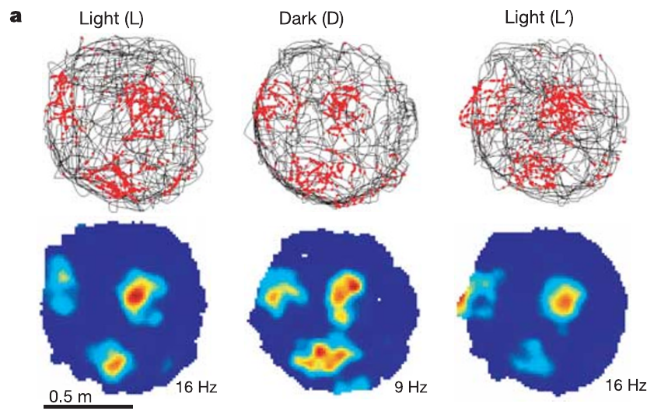
Grid periodicity persists when the lights go off
Hafting and colleagues recorded a grid cell during 10 min of light, 10 min of darkness and a return to light. The animal remained in the recording environment throughout these changes. The session alternated light and darkness while the cell's firing was recorded.
The grid pattern persisted in darkness, although fields could become somewhat dispersed or displaced. Self-motion information comprises signals related to the animal's own movement, which remain available when visual landmarks are absent. The grid geometry remained identifiable in darkness, which shows that visual input is not required for periodicity.
Persistence without vision is consistent with movement-based updating of location. Odors, touch and environmental boundaries remain available in darkness, so the result supports a contribution from self-motion alongside other cues. Movement signals can therefore maintain the pattern when the visual scene is absent.
Hafting et al. (2005), Fig. 1(a). Nissl-stained rat entorhinal recording site.
Hafting et al. (2005), Fig. 5(a). Trajectory and rate maps across light conditions.
Hafting et al. (2005)
24
Notes:
Hafting and colleagues recorded a grid cell during 10 min of light, 10 min of darkness, and a return to light. The animal remained in the recording environment during these changes.
The grid pattern persisted in darkness, although fields could become somewhat dispersed or displaced. **Self-motion information** comprises signals related to the animal's own movement, which remain available even when visual landmarks are absent.
Persistence without vision is consistent with movement-based updating of location. Darkness does not remove every external cue: odors, touch, and environmental boundaries can remain available. The experiment therefore supports a contribution from self-motion without proving that the grid operates independently of all environmental information.
References:
Hafting T, Fyhn M, Molden S, Moser MB, Moser EI (2005). Microstructure of a spatial map in the entorhinal cortex. Nature 436(7052): 801–806. https://doi.org/10.1038/nature03721

Slide 32
Grid firing remains in the dark
Hafting and colleagues recorded a grid cell across 10 min of light, 10 min of darkness and a return to light. The animal stayed in the same environment throughout the session. The cell's firing was recorded in each light condition, so the three segments can be compared within one session.
The grid pattern persisted in darkness, although its fields became somewhat dispersed or displaced. Self-motion signals, which come from the animal's own movement, stay available when visual landmarks are removed. The fields in darkness stayed periodic and recognizable, even though their positions shifted somewhat.
Persistence without vision fits movement-based updating of location. Odors, touch and boundaries remain available, so self-motion is one of several inputs that can drive the pattern in darkness. The animal's self-motion therefore supplies information that persists when the visual scene is removed.
Hafting et al. (2005), Fig. 1(a). Nissl-stained rat entorhinal recording site.
Hafting et al. (2005), Fig. 5(a). Trajectory and rate maps across light conditions.
Hafting et al. (2005)
24a
Notes:
Grid firing remains in the dark.
Protocol.
Light, darkness and light were alternated.
The animal stayed in the same room.
Result.
The grid pattern persisted in darkness.
Fields became somewhat dispersed.
Self-motion.
Movement signals remain without vision.
They update the estimate of location.
Meaning.
Movement contributes to the grid.
Other cues also remain available.
Explanation 1.
Hafting and colleagues recorded a grid cell across 10 min of light, 10 min of darkness and a return to light
The animal stayed in the same environment throughout the session. The cell's firing was recorded in each light condition, so the three segments can be compared within one session.
Explanation 2.
The grid pattern persisted in darkness, although its fields became somewhat dispersed or displaced
Self-motion signals, which come from the animal's own movement, stay available when visual landmarks are removed. The fields in darkness stayed periodic and recognizable, even though their positions shifted somewhat.
Explanation 3.
Persistence without vision fits movement-based updating of location
Odors, touch and boundaries remain available, so self-motion is one of several inputs that can drive the pattern in darkness. The animal's self-motion therefore supplies information that persists when the visual scene is removed.
References:
Hafting T, Fyhn M, Molden S, Moser MB, Moser EI (2005). Microstructure of a spatial map in the entorhinal cortex. Nature 436(7052): 801–806. https://doi.org/10.1038/nature03721

Slide 33
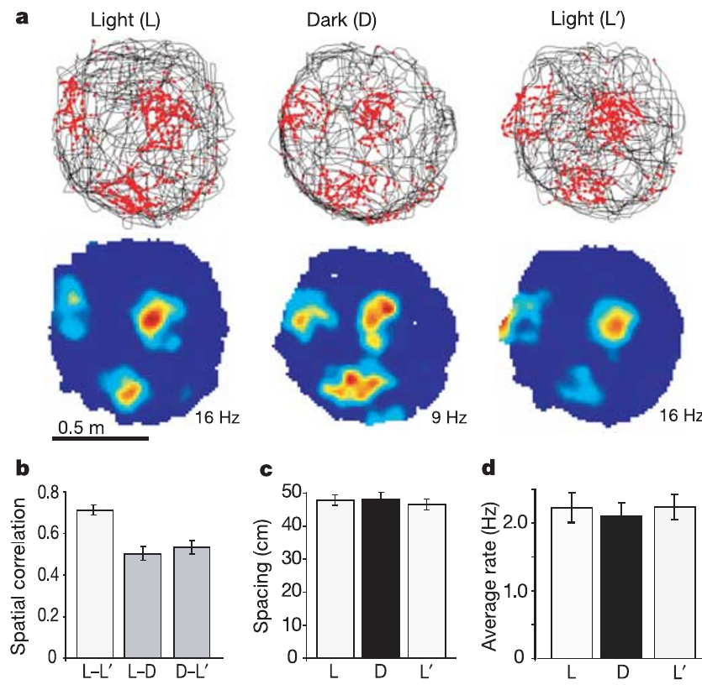
Path integration remains a supported mechanism
Path integration updates an estimate of location from movement since a reference position. A spatial code that persists in darkness fits this computation, because movement information can continue to update the estimate. The estimate of location accumulates the movement that the animal makes from the starting point.
Hafting and colleagues found no major change in grid spacing during visual deprivation. The preserved metric pattern contrasted with the ability of visible landmarks to change the grid's directional alignment. The spacing measure stayed nearly the same during the period of visual deprivation.
The combination distinguishes internally maintained geometry from external calibration. Path integration is a supported explanation of grid function, with movement signals maintaining the metric pattern while landmarks set its alignment. Movement-based updating and landmark calibration thus contribute to the same pattern.
Hafting et al. (2005), Fig. 1(a). Nissl-stained rat entorhinal recording site.
Hafting et al. (2005), Fig. 5(a–d). Grid activity during light and darkness.
Hafting et al. (2005)
25
Notes:
**Path integration** updates an estimate of location from movement since a reference position. A spatial code that persists in darkness is compatible with this computation because movement information can continue to update the estimate.
Hafting and colleagues found no major change in grid spacing during visual deprivation. The preserved metric pattern contrasted with the ability of visible landmarks to change the grid's directional alignment.
The combination supports a distinction between internally maintained geometry and external calibration. The recordings did not directly measure all movement signals or selectively remove them. Path integration was consequently a supported explanation of grid function, rather than a fully identified sequence of synaptic transformations established by the experiment.
References:
Hafting T, Fyhn M, Molden S, Moser MB, Moser EI (2005). Microstructure of a spatial map in the entorhinal cortex. Nature 436(7052): 801–806. https://doi.org/10.1038/nature03721

Slide 34
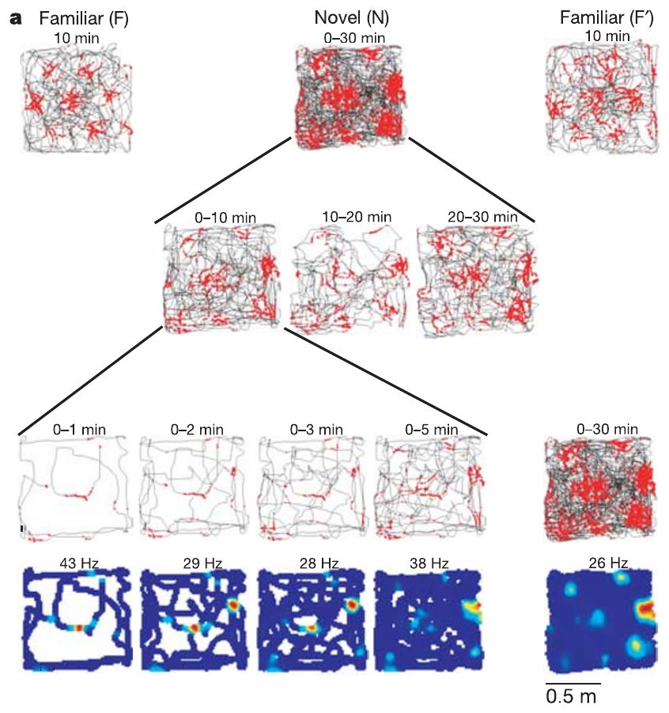
Grid structure appears rapidly in a novel room
The animals were tested in a familiar room, a novel room and the familiar room again. Repeated firing fields were already present early in the novel environment, rather than appearing after prolonged experience with that room. The novel room was introduced after the familiar room, and the animal's return tested the original room again.
Hafting and colleagues divided the novel-room trial into short blocks. Activity during the first 2 min already related to the spatial pattern measured near the end of the trial, while the pattern became more stable with exposure. The first two minutes of the novel trial already carried the pattern seen later in the same trial.
Rapid expression supports transfer of a spatial organizing process across environments. Landmark associations are still forming during the trial, while the available grid geometry is expressed from the start of exposure. Each trial therefore shows a structure that was present early and then strengthened.
Hafting et al. (2005), Fig. 1(a). Nissl-stained rat entorhinal recording site.
Hafting et al. (2005), Fig. 6(a). Spatial firing during novel-room exposure.
Hafting et al. (2005)
26
Notes:
The animals were tested in a familiar room, a novel room, and the familiar room again. Repeated firing fields were present early in the novel environment, rather than appearing only after prolonged experience with that particular room.
Hafting and colleagues divided the novel-room trial into short blocks. Activity during the first 2 min already related to the spatial pattern measured near the end of the trial, while the pattern became more stable with exposure.
Rapid expression supports transfer of a spatial organizing process across environments. It does not mean that landmark associations are already complete on entry. An available grid geometry and the stabilization of its alignment are separate aspects of the response.
References:
Hafting T, Fyhn M, Molden S, Moser MB, Moser EI (2005). Microstructure of a spatial map in the entorhinal cortex. Nature 436(7052): 801–806. https://doi.org/10.1038/nature03721

Slide 35
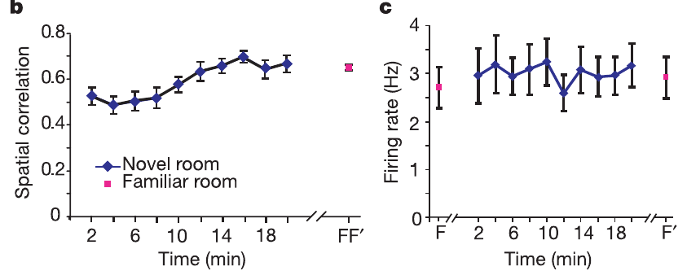
Experience stabilizes alignment without creating the lattice
The novel-room rate maps became more consistent during continued exploration. Stability was measured by comparing firing at corresponding locations during earlier portions of a trial and its final portion. The stability values compare the rate maps of the early and late portions of the same trial.
The grid's orientation also differed between the familiar and novel rooms, while repeated familiar-room tests showed much smaller changes. The same spatial organizing principle was therefore expressed with room-specific alignment. Familiar-room tests showed small changes in alignment, while the novel-room changes were larger.
The authors proposed that learning builds associations between landmarks and the grid's phase and orientation. This account explains the gradual stabilization of alignment, and the study measured the changes in spatial activity that such associations would produce. Repeated experience with landmarks is therefore the likely source of the room-specific alignment.
Hafting et al. (2005), Fig. 1(a). Nissl-stained rat entorhinal recording site.
Hafting et al. (2005), Fig. 6(b,c). Rate-map stabilization across exploration.
Hafting et al. (2005)
27
Notes:
The novel-room rate maps became more consistent during continued exploration. Stability was measured by comparing firing at corresponding locations during earlier portions of a trial and its final portion.
The grid's orientation also differed between the familiar and novel rooms, while repeated familiar-room tests had much smaller changes. The same spatial organizing principle could therefore be expressed with room-specific alignment.
The authors proposed that learning establishes associations between landmarks and the grid's phase and orientation. That proposal accounts for gradual stabilization but does not identify a particular plasticity receptor or synapse. The study measured changes in spatial activity, not the molecular events that stored those associations.
References:
Hafting T, Fyhn M, Molden S, Moser MB, Moser EI (2005). Microstructure of a spatial map in the entorhinal cortex. Nature 436(7052): 801–806. https://doi.org/10.1038/nature03721

Slide 36
Landmark experience aligns the grid to a new room
Hafting and colleagues compared a familiar room with a novel room and tested the familiar room again. Rate maps in the novel room became more consistent during continued exploration. The stability values are computed from the same cell at the start and end of the trial, so change is directly measured.
The grid's orientation differed between the familiar and novel rooms, while repeated familiar-room tests changed much less. The same organizing principle was therefore expressed with room-specific alignment. The room-specific alignment was therefore a difference in orientation rather than a change in the lattice's periodicity.
The authors proposed that learning builds associations between landmarks and the grid's phase and orientation. This account explains the gradual stabilization of alignment that appeared over continued exploration. Repeated experience with each room builds these alignments, which the authors linked to landmark associations.
Hafting et al. (2005), Fig. 1(a). Nissl-stained rat entorhinal recording site.
Hafting et al. (2005), Fig. 6(b,c). Rate-map stabilization across exploration.
Hafting et al. (2005)
27a
Notes:
Landmark experience aligns the grid to a new room.
Rooms.
A familiar room, a novel room and a return were tested.
Exploration continued in each.
Alignment.
The novel-room orientation differed.
Familiar-room tests changed less.
Stability.
Novel-room maps became more consistent.
Stability grew with exploration.
Meaning.
Landmark associations shape the alignment.
The learned alignment is room-specific.
Explanation 1.
Hafting and colleagues compared a familiar room with a novel room and tested the familiar room again
Rate maps in the novel room became more consistent during continued exploration. The stability values are computed from the same cell at the start and end of the trial, so change is directly measured.
Explanation 2.
The grid's orientation differed between the familiar and novel rooms, while repeated familiar-room tests changed much less
The same organizing principle was therefore expressed with room-specific alignment. The room-specific alignment was therefore a difference in orientation rather than a change in the lattice's periodicity.
Explanation 3.
The authors proposed that learning builds associations between landmarks and the grid's phase and orientation
This account explains the gradual stabilization of alignment that appeared over continued exploration. Repeated experience with each room builds these alignments, which the authors linked to landmark associations.
References:
Hafting T, Fyhn M, Molden S, Moser MB, Moser EI (2005). Microstructure of a spatial map in the entorhinal cortex. Nature 436(7052): 801–806. https://doi.org/10.1038/nature03721

Slide 37
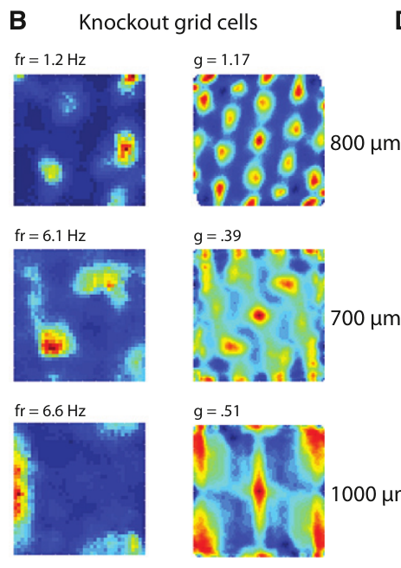
HCN1 deletion tests a cellular contribution to grid scale
Giocomo and colleagues tested whether an ion-channel protein, HCN1, contributes to spatial scale. They recorded grid cells in mice with forebrain-restricted HCN1 knockout, a deletion that removes functional expression of the gene in the affected tissue. The HCN1 gene was deleted in the forebrain, and the spatial responses of grid cells were then recorded.
Littermate controls provided a comparison for the genetic manipulation, and experimenters were unaware of group identity during collection and preliminary analysis. Recordings sampled superficial medial entorhinal cortex while mice explored open fields. The littermate controls shared the same genetic background as the knockout animals.
The intervention moved beyond observing a scale gradient to altering a candidate molecular contributor. Because the deletion covered the forebrain rather than the recorded grid cells alone, the effect reflects the circuit in which those cells sit. The forebrain deletion covers the entorhinal input that the recorded cells receive.
Giocomo et al. (2011), Fig. 3(A, upper histology). Mouse sagittal brain section and entorhinal recording location.
Giocomo et al. (2011), Fig. 1(B). Grid-cell patterns after HCN1 knockout.
Giocomo et al. (2011)
28
Notes:
Giocomo and colleagues tested whether an ion-channel protein contributes to spatial scale by recording grid cells in mice with forebrain-restricted **HCN1 knockout**. A knockout removes functional expression of the targeted gene in the affected tissue.
Littermate controls provided a comparison for the genetic manipulation, and experimenters remained unaware of group identity during collection and preliminary analysis. Recordings sampled superficial medial entorhinal cortex while mice explored open fields.
The intervention moved beyond observing a scale gradient to altering a candidate molecular contributor. Because the deletion affected the forebrain rather than only recorded grid cells, the results cannot be assigned exclusively to a cell-autonomous action of HCN1 within each recorded neuron.
References:
Giocomo LM, Hussaini SA, Zheng F, Kandel ER, Moser MB, Moser EI (2011). Grid cells use HCN1 channels for spatial scaling. Cell 147(5): 1159–1170. https://doi.org/10.1016/j.cell.2011.08.051

Slide 38
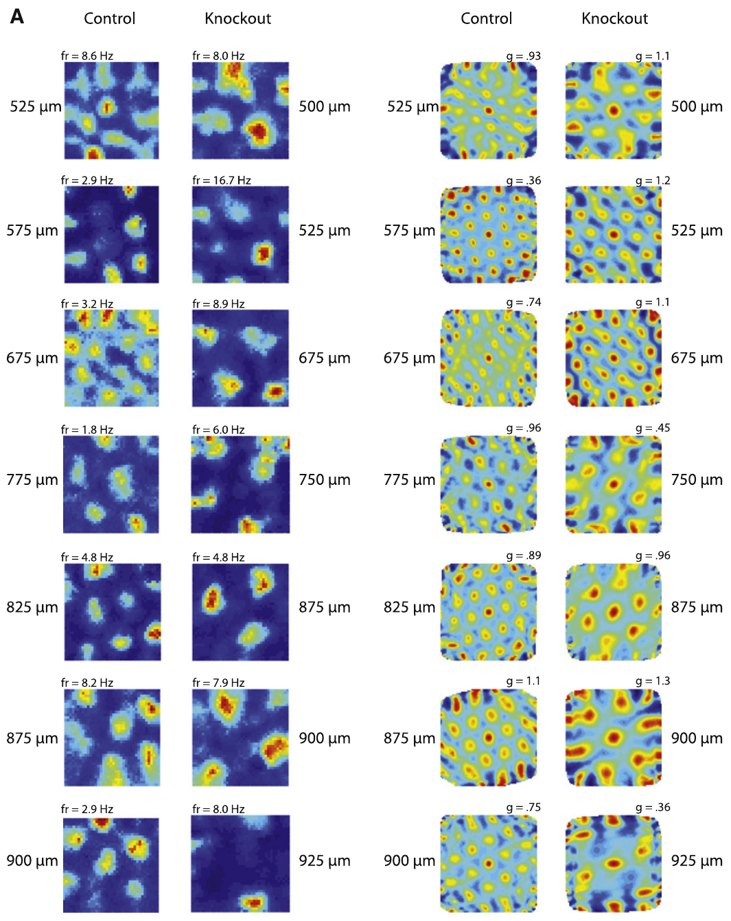
HCN channels influence how neurons integrate input
HCN denotes hyperpolarization-activated cyclic nucleotide-gated channels. These channels conduct the inward cation current called I_h, and they shape membrane responses and the time window over which inputs interact. The channel carries the Ih current, which is inward and depends on the cyclic nucleotide signal.
Prior cellular evidence showed that reducing HCN1 slows resonance and temporal integration in entorhinal layer II cells. Giocomo and colleagues used that evidence as the rationale for recording spatial activity after forebrain deletion, and temporal integration is the combination of inputs arriving at different times. Reducing HCN1 changes the time over which the inputs of entorhinal layer II neurons sum.
The knockout grid maps connect the channel intervention to altered spatial firing. The link between membrane integration and the transformation of movement into spatial position is a mechanistic interpretation supported by the observed changes in scale. The mechanism links the channel's membrane effect to the spatial scale of the grid.
Giocomo et al. (2011), Fig. 3(A, upper histology). Mouse sagittal brain section and entorhinal recording location.
Giocomo et al. (2011), Fig. 2(A). Grid patterns at several recording depths.
Giocomo et al. (2011)
29
Notes:
**HCN** denotes hyperpolarization-activated cyclic nucleotide-gated channels. These channels conduct the inward cation current called **Ih** and influence membrane responses and the time over which inputs can interact.
Giocomo and colleagues used prior cellular evidence that reducing HCN1 slows resonance and temporal integration in entorhinal layer II cells as the rationale for recording spatial activity after forebrain deletion. **Temporal integration** is the combination of inputs arriving at different times.
The knockout grid maps connect the channel intervention to altered spatial firing. They do not directly measure Ih in the same recorded grid cells. The relationship between membrane integration and the movement-to-space transformation remains a mechanistic interpretation constrained by the observed changes in scale.
References:
Giocomo LM, Hussaini SA, Zheng F, Kandel ER, Moser MB, Moser EI (2011). Grid cells use HCN1 channels for spatial scaling. Cell 147(5): 1159–1170. https://doi.org/10.1016/j.cell.2011.08.051

Slide 39
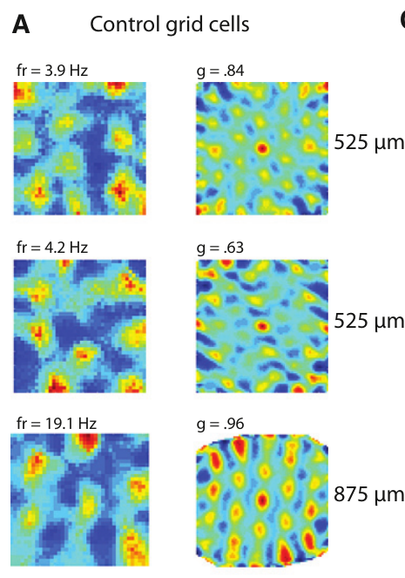
A large open field reveals the knockout grid pattern
Mice explored a 100 × 100 cm box and, in additional sessions, a 50 × 50 cm box. The larger environment provided enough extent to recognize repeated fields across the sampled dorsal-to-ventral recording range. The larger box provided enough room for the repeated fields to appear across the recording range.
The smaller box supported measurements of boundary-related and head-direction activity, but it did not reveal every grid's full periodicity. The principal grid-cell comparison therefore came from recordings in the larger environment. The principal comparison of grid cells therefore came from the larger environment.
Arena dimensions determine how much of a spatial pattern can be sampled. A lattice that is missing from a small box can still be present, and this control matters most when a manipulation enlarges spacing and reduces the number of visible fields. Arena size and recording depth together determine which fields are visible.
Giocomo et al. (2011), Fig. 3(A, upper histology). Mouse sagittal brain section and entorhinal recording location.
Giocomo et al. (2011), Fig. 1(A). Control grid-cell rates and autocorrelations.
Giocomo et al. (2011)
30
Notes:
Mice explored a 100 × 100 cm box and, in additional sessions, a 50 × 50 cm box. The larger environment provided sufficient extent to recognize repeated fields over the sampled dorsal-to-ventral recording range.
The smaller box supported measurements of boundary-related and head-direction activity, but did not reveal every grid's full periodicity. The researchers consequently based the principal grid-cell comparison on recordings from the larger environment.
Arena dimensions determine how much of a spatial pattern can be sampled. Failure to recognize a lattice in a small box does not establish that a neuron lacks periodic activity. This control is particularly relevant when a manipulation enlarges spacing and reduces the number of visible fields.
References:
Giocomo LM, Hussaini SA, Zheng F, Kandel ER, Moser MB, Moser EI (2011). Grid cells use HCN1 channels for spatial scaling. Cell 147(5): 1159–1170. https://doi.org/10.1016/j.cell.2011.08.051

Slide 40
The larger box reveals the knockout grid pattern
The 100 × 100 cm box provided enough extent to recognize repeated fields across the dorsal-to-ventral range. Mice explored this larger box in the main sessions of the HCN1 experiment. The 100 × 100 cm box spanned enough distance for the repeated fields to appear across the dorsal-to-ventral range.
The 50 × 50 cm box supported measurements of boundary-related and head-direction activity. Its size did not reveal every grid's full periodicity, so the principal grid comparison used the larger box. The grid comparison used the larger environment, where the periodic fields could be counted.
Arena dimensions set how much of a spatial pattern can be sampled. A lattice missing from a small box can still be present, which makes the larger box important when spacing is enlarged. Arena size and recording depth together determine which fields a recording can reveal.
Giocomo et al. (2011), Fig. 3(A, upper histology). Mouse sagittal brain section and entorhinal recording location.
Giocomo et al. (2011), Fig. 1(A). Control grid-cell rates and autocorrelations.
Giocomo et al. (2011)
30a
Notes:
The larger box reveals the knockout grid pattern.
Main box.
Mice explored a 100 × 100 cm box.
The extent showed repeated fields.
Small box.
A 50 × 50 cm box was used in extra sessions.
It supported boundary and head-direction measures.
Control.
Arena size sets how much pattern is sampled.
Enlarged spacing needs a large box.
Meaning.
The grid comparison rests on the larger box.
Periodicity is visible when enough fields are sampled.
Explanation 1.
The 100 × 100 cm box provided enough extent to recognize repeated fields across the dorsal-to-ventral range
Mice explored this larger box in the main sessions of the HCN1 experiment. The 100 × 100 cm box spanned enough distance for the repeated fields to appear across the dorsal-to-ventral range.
Explanation 2.
The 50 × 50 cm box supported measurements of boundary-related and head-direction activity
Its size did not reveal every grid's full periodicity, so the principal grid comparison used the larger box. The grid comparison used the larger environment, where the periodic fields could be counted.
Explanation 3.
Arena dimensions set how much of a spatial pattern can be sampled
A lattice missing from a small box can still be present, which makes the larger box important when spacing is enlarged. Arena size and recording depth together determine which fields a recording can reveal.
References:
Giocomo LM, Hussaini SA, Zheng F, Kandel ER, Moser MB, Moser EI (2011). Grid cells use HCN1 channels for spatial scaling. Cell 147(5): 1159–1170. https://doi.org/10.1016/j.cell.2011.08.051

Slide 41
HCN1 knockout preserves periodic grid firing
Grid cells remained present after forebrain HCN1 deletion. Their rate maps and spatial autocorrelations kept repeated, approximately hexagonal organization, so HCN1 was not required for every expression of the grid pattern. The spatial autocorrelations showed the same hexagonal arrangement in knockout and control cells.
Giocomo and colleagues compared the observed spatial patterns with patterns obtained by shifting spike timing relative to the animal's path. This shuffle control keeps the spike sequence while breaking its original association with position. The shuffled spike pattern lost the spatial organization of the grid, which confirmed that the pattern was real.
Preserved periodicity distinguishes the generation of grid-like structure from the regulation of its scale. Other HCN subunits, other intrinsic currents and circuit interactions can all contribute to network activity after HCN1 is removed. The grid pattern therefore depends on more than HCN1 for its existence.
Giocomo et al. (2011), Fig. 3(A, upper histology). Mouse sagittal brain section and entorhinal recording location.
Giocomo et al. (2011), Fig. 1(B). Grid-cell patterns after HCN1 knockout.
Giocomo et al. (2011)
31
Notes:
Grid cells remained present after forebrain HCN1 deletion. Their rate maps and spatial autocorrelations retained repeated, approximately hexagonal organization, establishing that HCN1 was not required for every expression of the grid pattern.
Giocomo and colleagues compared observed spatial patterns with patterns obtained by shifting spike timing relative to the animal's path. This **shuffle control** preserves the spike sequence while disrupting its original association with position.
Preserved periodicity separates generation of grid-like structure from regulation of its scale. The result does not establish that Ih has no contribution to the network: other HCN subunits, other intrinsic currents, and circuit interactions can remain after removal of HCN1.
References:
Giocomo LM, Hussaini SA, Zheng F, Kandel ER, Moser MB, Moser EI (2011). Grid cells use HCN1 channels for spatial scaling. Cell 147(5): 1159–1170. https://doi.org/10.1016/j.cell.2011.08.051

Slide 42
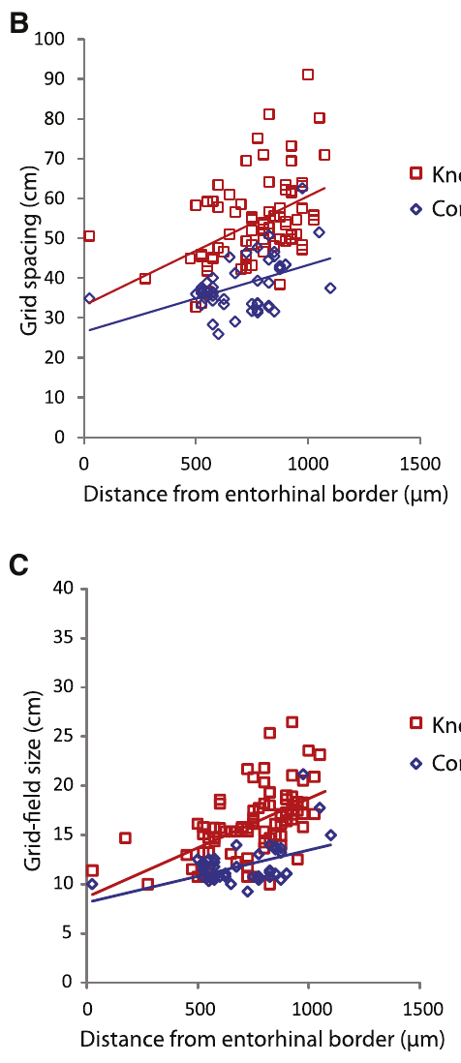
Spatial spacing is larger after HCN1 deletion
Grid spacing was greater in knockout mice than in controls across the sampled anatomical positions. Giocomo and colleagues plotted spacing against distance from the dorsal border of medial entorhinal cortex. The spacing values were plotted for each recorded cell across the entorhinal depth.
Comparing cells at similar anatomical levels reduced confusion between a genetic effect and the normal dorsal-to-ventral scale difference. The knockout relationship sat at larger spacing values while still increasing toward ventral positions. The gradient of spacing with depth remained in the knockout data.
HCN1 expression therefore contributes to the normal range of spatial scale. The measured outcome is a change in the distance between activity fields, which shows that the channel tunes spacing while spatial coding remains intact. The channel thus adjusts the spatial scale within a gradient that the tissue already carries.
Giocomo et al. (2011), Fig. 3(A, upper histology). Mouse sagittal brain section and entorhinal recording location.
Giocomo et al. (2011), Fig. 2(B,C). Grid spacing and field size versus depth.
Giocomo et al. (2011)
32
Notes:
Grid spacing was greater in knockout mice than in controls across the sampled anatomical positions. Giocomo and colleagues plotted spacing against distance from the dorsal border of medial entorhinal cortex.
Comparing cells at similar anatomical levels reduced confusion between a genetic effect and the normal dorsal-to-ventral scale difference. The knockout relationship was shifted toward larger spacing while still increasing toward ventral positions.
The intervention establishes that HCN1 expression contributes to the normal range of spatial scale. It does not establish the exact synaptic calculation by which the channel changes spacing. The measured outcome is a change in the distance between activity fields, rather than disappearance of spatial coding.
References:
Giocomo LM, Hussaini SA, Zheng F, Kandel ER, Moser MB, Moser EI (2011). Grid cells use HCN1 channels for spatial scaling. Cell 147(5): 1159–1170. https://doi.org/10.1016/j.cell.2011.08.051

Slide 43
Field size and spacing expand proportionately
HCN1 knockout enlarged both grid spacing and the size of individual fields. These two measurements distinguish the distance between repeated peaks from the extent of each elevated firing region. The measurements were taken for the same cells, so each ratio reflects one neuron's pattern.
The reported spacing-to-field-size ratios were about 3.26 in controls and 3.32 after knockout. Their similarity supports coordinated expansion of the pattern, rather than selective broadening of fields without a corresponding spacing change. The two ratios were close in the two genotypes, which indicates a common scaling.
A proportionately enlarged grid represents a coarser metric pattern. The experiment quantified spatial firing during exploration, a measure that is separate from navigational accuracy or memory. The grid's coarser scale therefore reflects a change in both spacing and field extent.
Giocomo et al. (2011), Fig. 3(A, upper histology). Mouse sagittal brain section and entorhinal recording location.
Giocomo et al. (2011), Fig. 2(B,C). Grid spacing and field size versus depth.
Giocomo et al. (2011)
33
Notes:
HCN1 knockout enlarged both grid spacing and the size of individual fields. These two measurements distinguished distance between repeated peaks from the extent of each elevated firing region.
The reported spacing-to-field-size ratios were approximately 3.26 in controls and 3.32 after knockout. Their similarity supports coordinated expansion of the pattern rather than selective broadening of fields without a corresponding spacing change.
A proportionately enlarged grid represents a coarser metric pattern. It does not directly imply poorer behavioral performance or reduced ability to identify a location. The experiment quantified neuronal spatial firing during exploration, and that measurement must be distinguished from a separate test of navigational accuracy or memory.
References:
Giocomo LM, Hussaini SA, Zheng F, Kandel ER, Moser MB, Moser EI (2011). Grid cells use HCN1 channels for spatial scaling. Cell 147(5): 1159–1170. https://doi.org/10.1016/j.cell.2011.08.051

Slide 44
HCN1 knockout scales the whole grid
HCN1 knockout enlarged both grid spacing and the size of individual fields. These measurements distinguish the distance between repeated peaks from the extent of each elevated firing region. The field size is measured from the extent of the elevated region, which is a separate measure from the spacing.
The spacing-to-field-size ratio was about 3.26 in controls and 3.32 after knockout. The near-identical ratios show that the whole pattern expanded together. The ratios were computed for each genotype from the same measured cells, and both values were close to each other, so the scaling is shared by the two groups.
A proportionately enlarged grid is a coarser metric pattern. The experiment measured spatial firing during exploration, a quantity that is separate from navigational accuracy or memory. The enlarged grid therefore keeps its proportions, with spacing and field size growing in step.
Giocomo et al. (2011), Fig. 3(A, upper histology). Mouse sagittal brain section and entorhinal recording location.
Giocomo et al. (2011), Fig. 2(B,C). Grid spacing and field size versus depth.
Giocomo et al. (2011)
33a
Notes:
HCN1 knockout scales the whole grid.
Measures.
Spacing and field size were both measured.
Peak distance differs from field extent.
Ratio.
The spacing-to-field-size ratio was about 3.3.
It matched across genotypes.
Scale.
The whole pattern expanded together.
The grid became coarser.
Meaning.
The measure is spatial firing during exploration.
Navigation requires its own test.
Explanation 1.
HCN1 knockout enlarged both grid spacing and the size of individual fields
These measurements distinguish the distance between repeated peaks from the extent of each elevated firing region. The field size is measured from the extent of the elevated region, which is a separate measure from the spacing.
Explanation 2.
The spacing-to-field-size ratio was about 3.26 in controls and 3.32 after knockout
The near-identical ratios show that the whole pattern expanded together. The ratios were computed for each genotype from the same measured cells, and both values were close to each other, so the scaling is shared by the two groups.
Explanation 3.
A proportionately enlarged grid is a coarser metric pattern
The experiment measured spatial firing during exploration, a quantity that is separate from navigational accuracy or memory. The enlarged grid therefore keeps its proportions, with spacing and field size growing in step.
References:
Giocomo LM, Hussaini SA, Zheng F, Kandel ER, Moser MB, Moser EI (2011). Grid cells use HCN1 channels for spatial scaling. Cell 147(5): 1159–1170. https://doi.org/10.1016/j.cell.2011.08.051

Slide 45
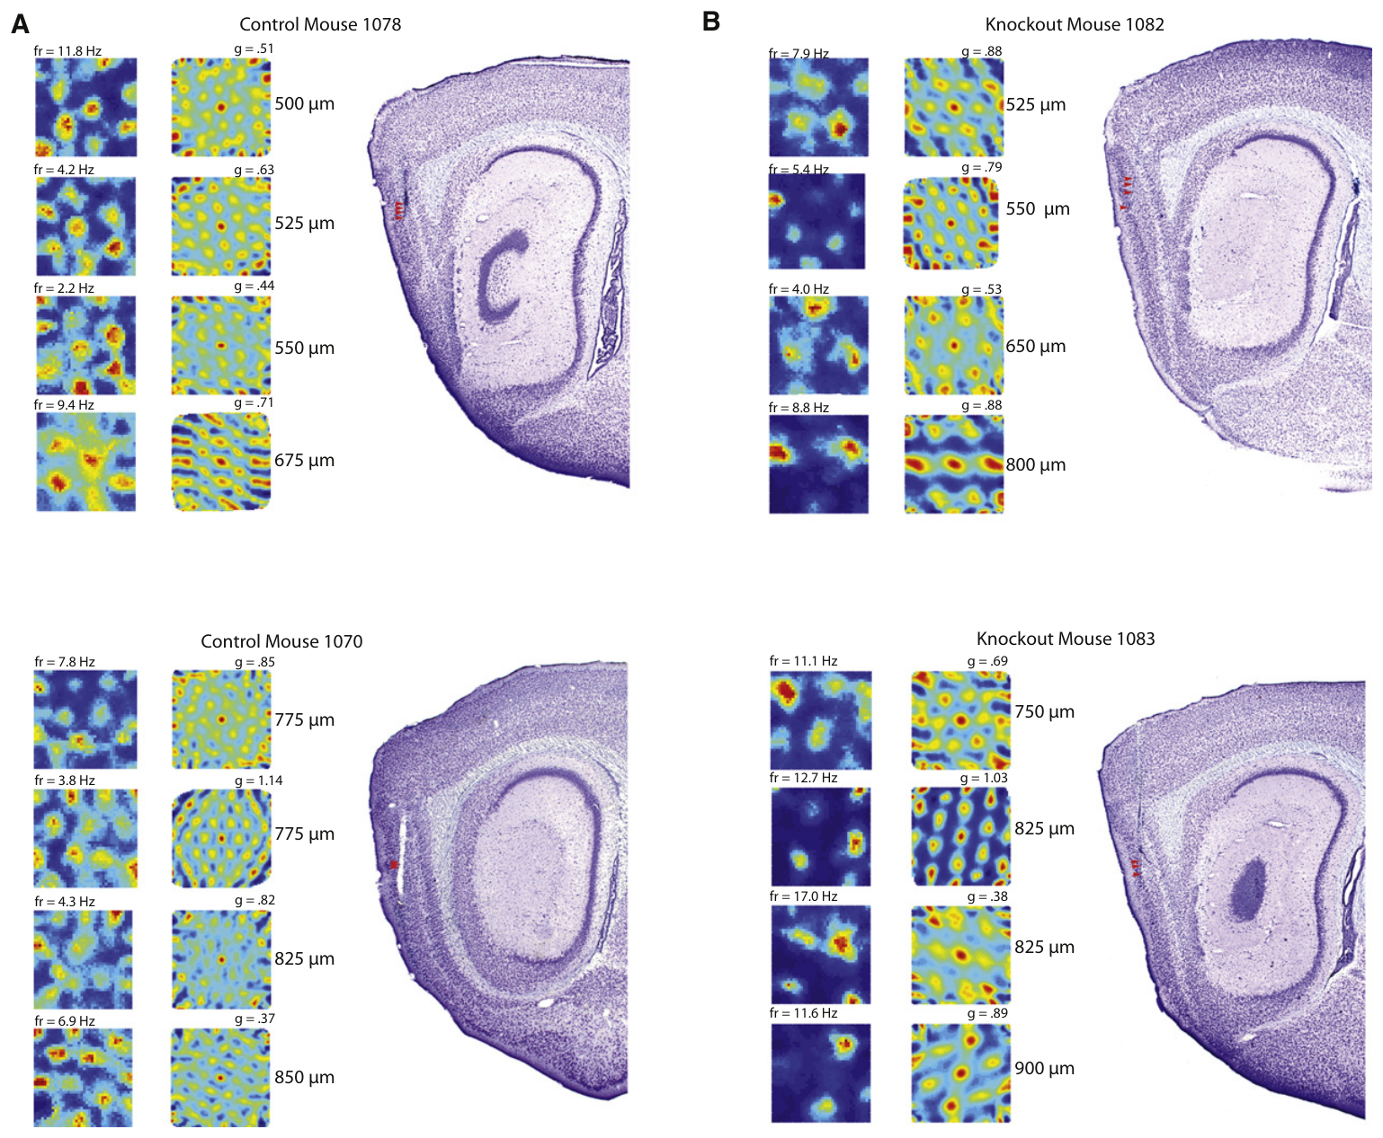
Histological matches strengthen the scale comparison
Giocomo and colleagues presented grid maps together with stained sections that located their recording sites. At similar distances from the dorsal entorhinal border, knockout examples had wider spacing than control examples. Each stained section identifies the electrode track and the cortical layers around it.
The anatomical reconstruction used sagittal sections and cortical staining patterns to identify medial entorhinal cortex and its layers. Cytoarchitecture is the arrangement and appearance of cells used to distinguish tissue regions. The staining makes the boundaries of the medial entorhinal cortex visible in the section.
Matching anatomical locations shows that the scale difference is not explained by recording deeper in the knockout group. Histology confirms where the electrodes sampled activity in each genotype. The matched sections show the knockout's wider spacing at comparable tissue positions.
Giocomo et al. (2011), Fig. 3(A, upper histology). Mouse sagittal brain section and entorhinal recording location.
Giocomo et al. (2011), Fig. 3(A,B). Grid fields and corresponding stained sections.
Giocomo et al. (2011)
34
Notes:
Giocomo and colleagues presented grid maps together with stained sections locating their recording sites. At similar distances from the dorsal entorhinal border, knockout examples had wider spacing than control examples.
The anatomical reconstruction used sagittal sections and cortical staining patterns to identify medial entorhinal cortex and its layers. **Cytoarchitecture** means the arrangement and appearance of cells used to distinguish tissue regions.
Matching anatomical locations makes a scale difference less likely to arise solely from recording deeper in the knockout group. Histology verifies where electrodes sampled activity, but does not prove identical cellular composition at every site or restrict a forebrain genetic manipulation to the neurons recorded there.
References:
Giocomo LM, Hussaini SA, Zheng F, Kandel ER, Moser MB, Moser EI (2011). Grid cells use HCN1 channels for spatial scaling. Cell 147(5): 1159–1170. https://doi.org/10.1016/j.cell.2011.08.051

Slide 46
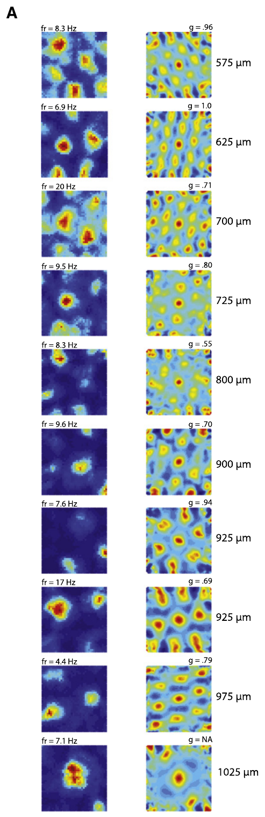
The dorsal-to-ventral scale gradient survives knockout
Within a single knockout animal, grid spacing still increased as recording locations moved away from the dorsal border. Giocomo and colleagues used this within-animal series to test whether HCN1 deletion abolished the anatomical organization of scale. The within-animal series sampled several depths of the same knockout brain.
The persistence of the gradient distinguishes a general expansion of the scale range from the loss of topographic organization. Topography is the systematic relationship between anatomical position and a measured functional property. The gradient survived the knockout, so the anatomical pattern of scale was retained.
HCN1 therefore contributes to scale without being the sole determinant of the dorsal-to-ventral relationship. Other cellular properties and circuit mechanisms are possible contributors, and the surviving gradient points toward them. The gradient's survival points to additional sources of scale beyond the channel.
Giocomo et al. (2011), Fig. 3(A, upper histology). Mouse sagittal brain section and entorhinal recording location.
Giocomo et al. (2011), Fig. 4(A). Grid patterns along one knockout recording series.
Giocomo et al. (2011)
35
Notes:
Within a single knockout animal, grid spacing still increased as recording locations progressed away from the dorsal border. Giocomo and colleagues used this within-animal series to test whether HCN1 deletion abolished the anatomical organization of scale.
The persistence of a gradient distinguished a general expansion of the scale range from loss of topographic organization. **Topography** is the systematic relationship between anatomical position and a measured functional property.
HCN1 therefore contributed to scale without providing the sole determinant of the dorsal-to-ventral relationship. Other cellular properties and circuit mechanisms remained possible contributors. The surviving gradient does not identify which of them is responsible, and it should not be attributed to a specific remaining current without additional measurements.
References:
Giocomo LM, Hussaini SA, Zheng F, Kandel ER, Moser MB, Moser EI (2011). Grid cells use HCN1 channels for spatial scaling. Cell 147(5): 1159–1170. https://doi.org/10.1016/j.cell.2011.08.051

Slide 47
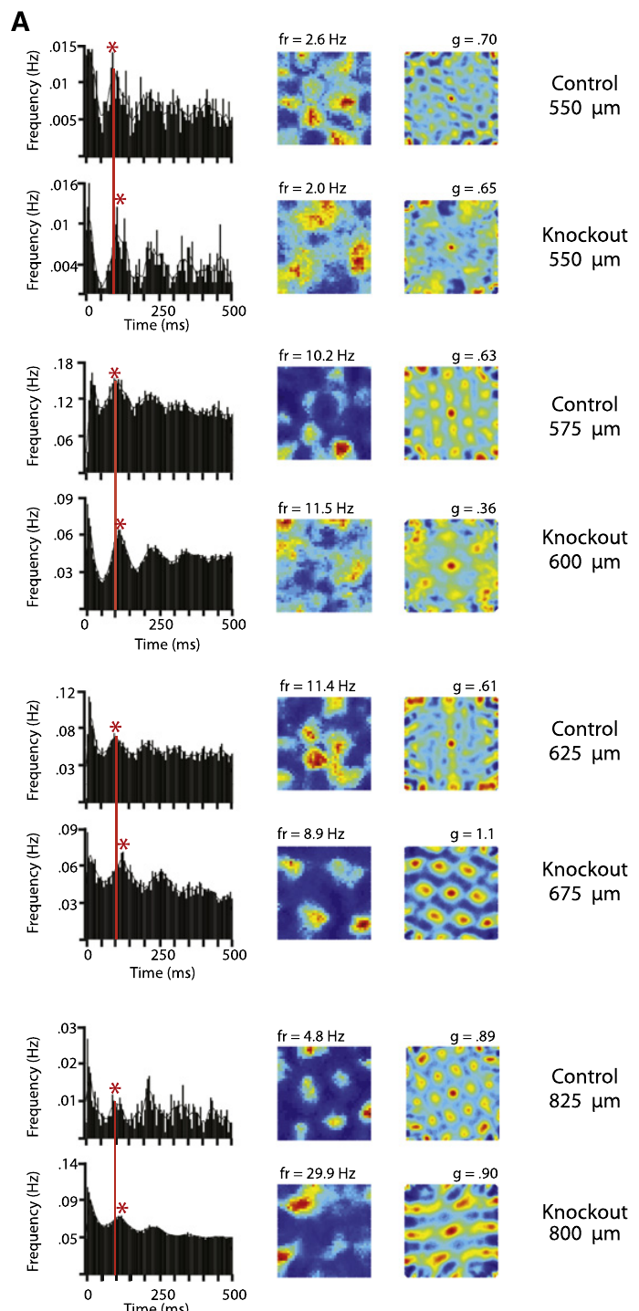
Slower theta timing accompanies larger grid spacing
Theta modulation is a recurring change in neuronal firing associated with a low-frequency rhythm. Giocomo and colleagues compared spike-time autocorrelations of grid cells in control and knockout mice. The autocorrelation of spike times shows the timing of recurring firing in each cell.
The typical interval between theta-related peaks was longer after knockout: 108.1 ms in controls and 114.4 ms in knockout grid cells. The enlarged spatial pattern therefore accompanied a slower recurring timescale of firing. Both values come from the same kind of grid-cell recording, so the difference is directly comparable.
A temporal autocorrelation measures how often spikes recur at different time lags, not the physical spacing of fields. The shared shift in timing and spacing constrains the mechanisms that could produce the knockout phenotype. The timing and spatial measures are separate outputs of the same grid cell.
Giocomo et al. (2011), Fig. 3(A, upper histology). Mouse sagittal brain section and entorhinal recording location.
Giocomo et al. (2011), Fig. 5(A). Spike-time and spatial autocorrelations.
Giocomo et al. (2011)
36
Notes:
**Theta modulation** is a recurring change in neuronal firing associated with a low-frequency rhythm. Giocomo and colleagues compared spike-time autocorrelations of grid cells in control and knockout mice.
The typical interval between theta-related peaks was longer after knockout: the reported values were 108.1 ms in controls and 114.4 ms in knockout grid cells. The enlarged spatial pattern therefore accompanied a slower recurring timescale of firing.
A **temporal autocorrelation** measures how often spikes recur at different time lags. It does not measure the physical spacing of fields. The association between slower timing and wider spacing constrains proposed mechanisms, but correlation of the two outcomes does not by itself establish which one causes the other.
References:
Giocomo LM, Hussaini SA, Zheng F, Kandel ER, Moser MB, Moser EI (2011). Grid cells use HCN1 channels for spatial scaling. Cell 147(5): 1159–1170. https://doi.org/10.1016/j.cell.2011.08.051

Slide 48
Theta timing and spacing move together
Giocomo and colleagues compared spike-time autocorrelations of grid cells in control and knockout mice. Theta-related peaks mark the recurring timing of firing in each cell. The autocorrelation of spike times reveals a recurring rhythm in each grid cell's discharge.
The typical interval between peaks was 108.1 ms in controls and 114.4 ms in knockout grid cells. Wider spatial spacing therefore came with a slower recurring timescale of firing. The knockout values are longer by about 6 ms, which is a small but consistent shift in timing.
A temporal autocorrelation measures how spikes recur at different lags, which is different from the physical spacing of fields. The shared shift in timing and spacing narrows the set of mechanisms that could explain the knockout. The shared shift in timing and spacing narrows the set of mechanisms that could explain the knockout phenotype.
Giocomo et al. (2011), Fig. 3(A, upper histology). Mouse sagittal brain section and entorhinal recording location.
Giocomo et al. (2011), Fig. 5(A). Spike-time and spatial autocorrelations.
Giocomo et al. (2011)
36a
Notes:
Theta timing and spacing move together.
Method.
Spike-time autocorrelations were compared.
Control and knockout mice were used.
Interval.
Peaks were spaced 108.1 ms in controls.
They were 114.4 ms in knockouts.
Link.
Wider spacing accompanied slower timing.
The two shifts occurred together.
Meaning.
Timing and spacing constrain mechanisms.
Both shift in the same cells.
Explanation 1.
Giocomo and colleagues compared spike-time autocorrelations of grid cells in control and knockout mice
Theta-related peaks mark the recurring timing of firing in each cell. The autocorrelation of spike times reveals a recurring rhythm in each grid cell's discharge.
Explanation 2.
The typical interval between peaks was 108.1 ms in controls and 114.4 ms in knockout grid cells
Wider spatial spacing therefore came with a slower recurring timescale of firing. The knockout values are longer by about 6 ms, which is a small but consistent shift in timing.
Explanation 3.
A temporal autocorrelation measures how spikes recur at different lags, which is different from the physical spacing of fields
The shared shift in timing and spacing narrows the set of mechanisms that could explain the knockout. The shared shift in timing and spacing narrows the set of mechanisms that could explain the knockout phenotype.
References:
Giocomo LM, Hussaini SA, Zheng F, Kandel ER, Moser MB, Moser EI (2011). Grid cells use HCN1 channels for spatial scaling. Cell 147(5): 1159–1170. https://doi.org/10.1016/j.cell.2011.08.051

Slide 49
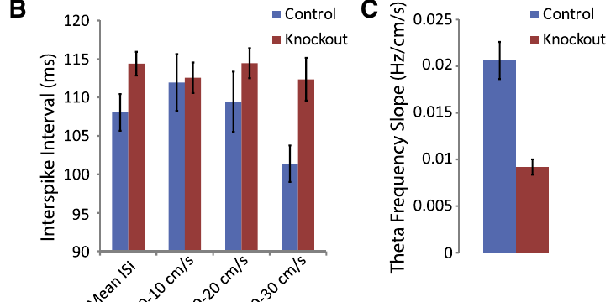
Running speed changes the timing comparison
Movement speed can influence theta-related activity, so Giocomo and colleagues compared groups across speed ranges. At 20–30 cm/s, the reported theta-related spike intervals were 101.4 ms in controls and 112.4 ms after HCN1 knockout. The speed ranges were chosen so both groups could be compared at matched movement.
The difference persisted at comparable speeds, which makes an explanation based on the knockout animals' faster average movement less likely. The speed comparison separated a behavioral covariate from the genetic change in neuronal timing. The difference in theta-related intervals persisted across the matched speed range.
The result is consistent with altered coupling between movement and the spatial code. HCN1 shapes neuronal integration, whereas the origin and routing of velocity-related inputs are a separate question for circuit measurements. Velocity-related inputs reach the grid network from other circuits.
Giocomo et al. (2011), Fig. 3(A, upper histology). Mouse sagittal brain section and entorhinal recording location.
Giocomo et al. (2011), Fig. 5(B,C). Theta timing and speed modulation.
Giocomo et al. (2011)
37
Notes:
Movement speed can influence theta-related activity, so Giocomo and colleagues compared groups across speed ranges. At 20–30 cm/s, the reported theta-related spike intervals were 101.4 ms in controls and 112.4 ms after HCN1 knockout.
The difference remained at comparable speeds, reducing an explanation based entirely on the knockout animals' faster average movement. The speed comparison separated a behavioral covariate from the genetic change in neuronal timing.
The result is consistent with altered coupling between movement and the spatial code. It does not establish that the channel directly detects speed. HCN1 influences neuronal integration, while the origin and routing of velocity-related inputs require separate circuit measurements.
References:
Giocomo LM, Hussaini SA, Zheng F, Kandel ER, Moser MB, Moser EI (2011). Grid cells use HCN1 channels for spatial scaling. Cell 147(5): 1159–1170. https://doi.org/10.1016/j.cell.2011.08.051

Slide 50
Local-field theta and single-cell timing are distinct
A local field potential is the extracellular voltage produced by coordinated activity in nearby tissue. Its theta frequency differs from the frequency inferred from repeated spikes of one neuron. Field theta is recorded from the population, whereas a single neuron's spikes give its own timing.
Giocomo and colleagues reported average entorhinal field-theta frequencies of 8.63 Hz in controls and 8.25 Hz after knockout. The increase of field-theta frequency with running speed was also weaker in knockout mice. The knockout field-theta frequency rose less steeply with speed than the control frequency.
These observations connect the channel intervention to population-level timing as well as to grid-cell scale. Individual discharge timing and the surrounding field rhythm are measured separately, so a proposed phase relationship can be tested against both. The two levels of timing point to population rhythms and single-cell discharge.
Giocomo et al. (2011), Fig. 3(A, upper histology). Mouse sagittal brain section and entorhinal recording location.
Giocomo et al. (2011), Fig. 5(B,C). Theta timing and speed modulation.
Giocomo et al. (2011)
38
Notes:
A **local field potential** is the extracellular voltage produced by coordinated activity in nearby tissue. Its theta frequency differs from the frequency inferred from repeated spikes of one neuron.
Giocomo and colleagues reported average entorhinal field-theta frequencies of 8.63 Hz in controls and 8.25 Hz after knockout. The increase of field-theta frequency with running speed was also weaker in knockout mice.
These observations connect the channel intervention to population-level timing as well as grid-cell scale. They do not establish that every recorded grid cell fires exactly once per field-theta cycle. Individual discharge timing and the surrounding field rhythm must be measured separately before a proposed phase relationship can be evaluated.
References:
Giocomo LM, Hussaini SA, Zheng F, Kandel ER, Moser MB, Moser EI (2011). Grid cells use HCN1 channels for spatial scaling. Cell 147(5): 1159–1170. https://doi.org/10.1016/j.cell.2011.08.051

Slide 51
Interneuron timing provides a cell-class comparison
An interneuron is a neuron whose principal connections remain within a local circuit. Giocomo and colleagues compared theta-modulated entorhinal interneurons with the principal cells that carry the grid-cell spatial pattern. The interneurons were recorded in the same region as the grid cells, so the two groups share one region.
The knockout-related increase in theta timing was present in grid cells and was not comparably detected in the simultaneously recorded interneuron population. The change therefore concerns grid cells specifically, rather than every recorded neuron. The interneurons showed no comparable change in theta timing in the knockout.
Cell-class differences constrain how a molecular intervention affects network dynamics. The selective physiological effect points to specific cell classes, which makes a targeted change in those classes the likely explanation. Each cell class therefore responds to the knockout in its own way.
Giocomo et al. (2011), Fig. 3(A, upper histology). Mouse sagittal brain section and entorhinal recording location.
Giocomo et al. (2011), Fig. 5(A). Spike-time and spatial autocorrelations.
Giocomo et al. (2011)
39
Notes:
An **interneuron** is a neuron whose principal connections remain within a local circuit. Giocomo and colleagues compared theta-modulated entorhinal interneurons with the principal cells carrying the grid-cell spatial pattern.
The knockout-related increase in theta timing was present in grid cells but was not comparably detected in the simultaneously recorded interneuron population. This comparison argues against a uniform slowing of every recorded neuron.
Cell-class differences constrain how a molecular intervention affects network dynamics. The study did not directly measure transmitter release or receptor currents from the recorded interneurons. Their comparison supports a selective physiological effect without specifying every inhibitory synapse or proving that all inhibitory circuitry remained unchanged.
References:
Giocomo LM, Hussaini SA, Zheng F, Kandel ER, Moser MB, Moser EI (2011). Grid cells use HCN1 channels for spatial scaling. Cell 147(5): 1159–1170. https://doi.org/10.1016/j.cell.2011.08.051

Slide 52
Interneurons keep their timing
An interneuron is a neuron whose principal connections stay within a local circuit. Giocomo and colleagues compared theta-modulated entorhinal interneurons with the principal grid cells. Interneurons are inhibitory cells in many circuits, and their timing is a sensitive readout of network state.
The increase in theta timing was present in grid cells but was not comparably detected in simultaneously recorded interneurons. The change therefore concerns grid cells specifically, rather than every recorded neuron. The interneurons were recorded at the same time as the grid cells, so the timing is measured within the same session.
Cell-class differences constrain how a molecular intervention reshapes network dynamics. The selective effect points to specific cell classes, which makes a targeted physiological change in those classes the likely explanation. Cell-class differences show that the knockout acts on some populations and spares others in the same region.
Giocomo et al. (2011), Fig. 3(A, upper histology). Mouse sagittal brain section and entorhinal recording location.
Giocomo et al. (2011), Fig. 5(A). Spike-time and spatial autocorrelations.
Giocomo et al. (2011)
39a
Notes:
Interneurons keep their timing.
Cells.
Interneurons were compared with grid cells.
Both were theta-modulated.
Timing.
The increase appeared in grid cells.
It was not detected in interneurons.
Selectivity.
The effect is specific to a cell class.
Every neuron was not slowed.
Meaning.
The intervention reshapes specific networks.
Cell classes respond differently.
Explanation 1.
An interneuron is a neuron whose principal connections stay within a local circuit
Giocomo and colleagues compared theta-modulated entorhinal interneurons with the principal grid cells. Interneurons are inhibitory cells in many circuits, and their timing is a sensitive readout of network state.
Explanation 2.
The increase in theta timing was present in grid cells but was not comparably detected in simultaneously recorded interneurons
The change therefore concerns grid cells specifically, rather than every recorded neuron. The interneurons were recorded at the same time as the grid cells, so the timing is measured within the same session.
Explanation 3.
Cell-class differences constrain how a molecular intervention reshapes network dynamics
The selective effect points to specific cell classes, which makes a targeted physiological change in those classes the likely explanation. Cell-class differences show that the knockout acts on some populations and spares others in the same region.
References:
Giocomo LM, Hussaini SA, Zheng F, Kandel ER, Moser MB, Moser EI (2011). Grid cells use HCN1 channels for spatial scaling. Cell 147(5): 1159–1170. https://doi.org/10.1016/j.cell.2011.08.051

Slide 53
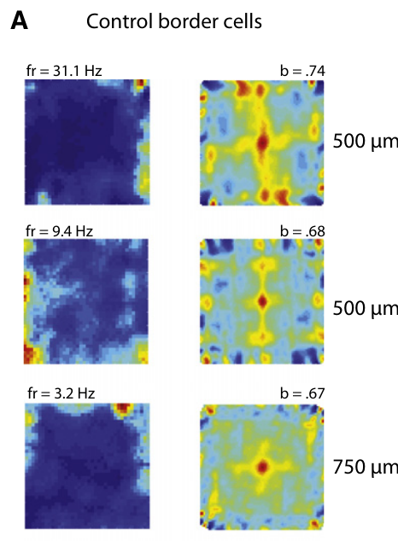
Border cells provide a separate boundary-related code
A border cell fires most strongly near one or more environmental boundaries. Giocomo and colleagues recorded boundary-related activity in the same entorhinal region used to study grid cells. The boundary firing is measured along the walls of the enclosure.
The maps concentrated activity along walls rather than at the repeated interior locations characteristic of a grid. Border-related firing remained identifiable after HCN1 deletion, providing a clear contrast with the enlarged grid pattern. The border responses remained after deletion, which shows that the knockout spared this code.
A boundary code supplies information different from grid spacing, because it relates activity to environmental edges. Its persistence shows that the knockout left other forms of spatial tuning in place. The border code and the grid code therefore represent different features of space.
Giocomo et al. (2011), Fig. 3(A, upper histology). Mouse sagittal brain section and entorhinal recording location.
Giocomo et al. (2011), Fig. 6(A). Boundary-related firing in control mice.
Giocomo et al. (2011)
40
Notes:
A **border cell** fires most strongly near one or more environmental boundaries. Giocomo and colleagues recorded boundary-related activity in the same entorhinal region used to study grid cells.
The maps concentrated activity along walls rather than at the repeated interior locations characteristic of a grid. Border-related firing remained identifiable after HCN1 deletion, providing a comparison with the enlarged grid pattern.
A boundary code supplies information different from grid spacing: it relates activity to environmental edges. Its persistence indicates that knockout did not eliminate every form of spatial tuning. The comparison does not establish how border-cell input interacts synaptically with the grid network or whether each class is independently sufficient for navigation.
References:
Giocomo LM, Hussaini SA, Zheng F, Kandel ER, Moser MB, Moser EI (2011). Grid cells use HCN1 channels for spatial scaling. Cell 147(5): 1159–1170. https://doi.org/10.1016/j.cell.2011.08.051

Slide 54
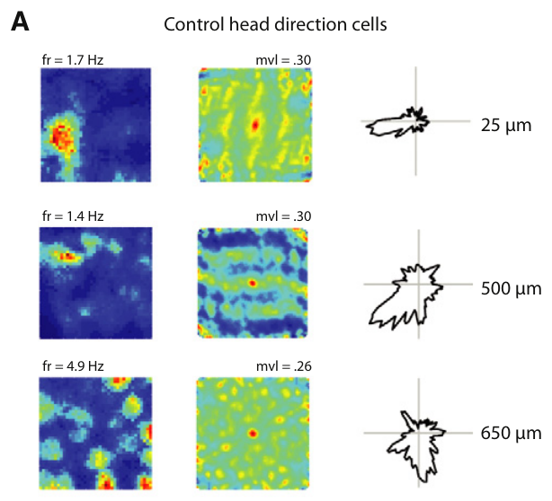
Head-direction cells represent where the animal faces
A head-direction cell fires preferentially when the animal's head points toward a particular direction. Giocomo and colleagues used two tracking lights to estimate heading and compared firing across angles. Heading was estimated from the position of the two tracking lights on the animal.
Directional tuning was present in control and knockout mice. A directional response is distinct from a grid field: an animal can face the preferred direction at several locations, whereas a grid cell's rate is organized by repeated spatial positions. Directional tuning appeared at similar strength in both genotypes.
The continued directional signal shows that heading information persists after the knockout. Heading and speed are the inputs that a grid network transforms into location, so measuring them in these circuits connects the directional signal to the grid pattern. Directional signals and grid firing therefore carry different information about the animal's position.
Giocomo et al. (2011), Fig. 3(A, upper histology). Mouse sagittal brain section and entorhinal recording location.
Giocomo et al. (2011), Fig. 7(A). Directional firing in control mice.
Giocomo et al. (2011)
41
Notes:
A **head-direction cell** fires preferentially when the animal's head points toward a particular direction. Giocomo and colleagues used two tracking lights to estimate heading and compared firing across angles.
Directional tuning remained present in control and knockout mice. A directional response is distinct from a grid field: an animal can face the preferred direction at several locations, whereas a grid cell's rate is organized by repeated spatial positions.
This comparison separates directional coding from the genetic effect on grid scale. The continued directional signal does not prove that it reaches every grid cell normally. Establishing the transformation from heading and speed into location requires measurements of the relevant inputs and their circuit interactions.
References:
Giocomo LM, Hussaini SA, Zheng F, Kandel ER, Moser MB, Moser EI (2011). Grid cells use HCN1 channels for spatial scaling. Cell 147(5): 1159–1170. https://doi.org/10.1016/j.cell.2011.08.051

Slide 55
HCN1 deletion increases within-trial spatial stability
Spatial stability describes the consistency of a neuron's firing pattern across repeated portions of a recording. Giocomo and colleagues compared maps from the first and second halves of each trial. The first and second halves of each trial were treated as independent portions of the same recording.
Grid and border patterns were more stable in knockout mice, while directional stability changed much less. The analysis also considered grid spacing, because broader patterns can appear more stable than narrower patterns under the same displacement. The stability analysis took the spacing of each cell into account.
Greater consistency of activity is distinct from greater spatial precision. A broader field can remain stable while distinguishing positions less sharply, so the stability difference describes the consistency of firing rather than navigational precision. The stability difference is a measure of the consistency of firing across the trial.
Giocomo et al. (2011), Fig. 3(A, upper histology). Mouse sagittal brain section and entorhinal recording location.
Giocomo et al. (2011), Fig. 2(A). Grid patterns at several recording depths.
Giocomo et al. (2011)
42
Notes:
**Spatial stability** describes the consistency of a neuron's firing pattern across repeated portions of a recording. Giocomo and colleagues compared maps from the first and second halves of each trial.
Grid and border patterns were more stable in knockout mice, while directional stability did not change comparably. The analysis also considered grid spacing because broader patterns can appear more stable than narrower patterns under the same displacement.
Greater consistency of activity is distinct from greater spatial precision. A broader field can remain stable while distinguishing positions less sharply. The observed stability difference therefore should not be equated directly with improved navigation or treated as proof of a specific synaptic plasticity mechanism.
References:
Giocomo LM, Hussaini SA, Zheng F, Kandel ER, Moser MB, Moser EI (2011). Grid cells use HCN1 channels for spatial scaling. Cell 147(5): 1159–1170. https://doi.org/10.1016/j.cell.2011.08.051

Slide 56
Knockout raises within-trial stability
Spatial stability describes how consistently a neuron fires across repeated portions of a recording. Giocomo and colleagues compared maps from the first and second halves of each trial. The two halves of each trial were compared for each recorded cell, so the stability index is cell-specific.
Grid and border patterns were more stable in knockout mice, while directional stability changed much less. Grid spacing was also considered, because broader patterns can look more stable under the same displacement. The grid and border maps became more stable, which the authors measured within the same knockout trials.
A broader field can stay stable while distinguishing positions less sharply. The stability difference therefore describes the consistency of firing, which is a separate property from spatial precision. The stability of firing and the precision of positions are therefore assessed with different measures.
Giocomo et al. (2011), Fig. 3(A, upper histology). Mouse sagittal brain section and entorhinal recording location.
Giocomo et al. (2011), Fig. 2(A). Grid patterns at several recording depths.
Giocomo et al. (2011)
42a
Notes:
Knockout raises within-trial stability.
Stability.
Maps from trial halves were compared.
Consistency defines stability.
Result.
Grid and border maps were more stable.
Directional stability changed less.
Spacing.
Broader patterns look more stable.
Spacing was accounted for.
Meaning.
Consistency differs from precision.
The result is about firing, not navigation.
Explanation 1.
Spatial stability describes how consistently a neuron fires across repeated portions of a recording
Giocomo and colleagues compared maps from the first and second halves of each trial. The two halves of each trial were compared for each recorded cell, so the stability index is cell-specific.
Explanation 2.
Grid and border patterns were more stable in knockout mice, while directional stability changed much less
Grid spacing was also considered, because broader patterns can look more stable under the same displacement. The grid and border maps became more stable, which the authors measured within the same knockout trials.
Explanation 3.
A broader field can stay stable while distinguishing positions less sharply
The stability difference therefore describes the consistency of firing, which is a separate property from spatial precision. The stability of firing and the precision of positions are therefore assessed with different measures.
References:
Giocomo LM, Hussaini SA, Zheng F, Kandel ER, Moser MB, Moser EI (2011). Grid cells use HCN1 channels for spatial scaling. Cell 147(5): 1159–1170. https://doi.org/10.1016/j.cell.2011.08.051

Slide 57
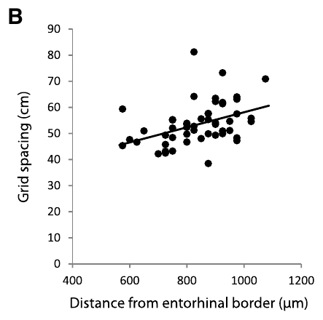
The knockout constrains oscillatory explanations of grids
An oscillatory interference model proposes that relationships between oscillations contribute to spatially periodic firing. Giocomo and colleagues examined their knockout results against proposed links between intrinsic timing and grid scale. The model predicts that a shared oscillation sets the periodic activity.
HCN1 deletion enlarged spacing but preserved the dorsal-to-ventral gradient. The authors contrasted that result with earlier cellular observations that HCN1 deletion strongly alters the anatomical gradient of resonance. The knockout produced a result that did not match the gradient predicted from the earlier resonance data.
The mismatch challenges explanations in which the HCN1-dependent resonance gradient alone determines the scale gradient. Different versions of the model make different predictions, and the forebrain intervention leaves other intrinsic currents and network interactions free to shape activity. Interference models must therefore explain why spacing changes without a change in the gradient.
Giocomo et al. (2011), Fig. 3(A, upper histology). Mouse sagittal brain section and entorhinal recording location.
Giocomo et al. (2011), Fig. 4(B). Spacing versus depth within a knockout animal.
Giocomo et al. (2011)
43
Notes:
An **oscillatory interference model** proposes that relationships between oscillations contribute to spatially periodic firing. Giocomo and colleagues examined their knockout results in relation to proposed links between intrinsic timing and grid scale.
HCN1 deletion enlarged spacing but preserved the dorsal-to-ventral gradient. The authors contrasted that result with earlier cellular observations that HCN1 deletion strongly alters the anatomical gradient of resonance.
The mismatch challenges explanations in which the HCN1-dependent resonance gradient alone determines the scale gradient. It does not disprove every oscillatory mechanism. Different versions make different predictions, and the forebrain intervention also leaves other intrinsic currents and network interactions available to influence activity.
References:
Giocomo LM, Hussaini SA, Zheng F, Kandel ER, Moser MB, Moser EI (2011). Grid cells use HCN1 channels for spatial scaling. Cell 147(5): 1159–1170. https://doi.org/10.1016/j.cell.2011.08.051

Slide 58
Spatial coding does not establish navigational causation
The three studies establish different levels of evidence: spatially dependent hippocampal responses, periodic entorhinal firing, and a genetic contribution to the spatial scale of that periodic activity. Each level answers a different question about the spatial code. Each study is classed by the kind of evidence it provides for the spatial code.
HCN1 knockout perturbs a candidate cellular mechanism, while grid recordings in darkness and under landmark rotation test conditions affecting an intact spatial code. Each manipulation constrains a different explanation of the measured firing. The darkness and rotation experiments tested whether the grid responds to self-motion and landmarks.
A causal account of navigation additionally requires linking the altered representation to behavior under a defined spatial demand, with controls for movement, sensory information and the broader effects of the intervention. Those tests would connect the neural code to behavior. Together these experiments define the next layer of evidence for spatial navigation.
Giocomo et al. (2011), Fig. 3(A, upper histology). Mouse sagittal brain section and entorhinal recording location.
Giocomo et al. (2011), Fig. 3(A,B). Grid fields and corresponding stained sections.
Giocomo et al. (2011)
44
Notes:
The three studies establish different levels of evidence: spatially dependent hippocampal responses, periodic entorhinal firing, and a genetic contribution to the spatial scale of that periodic activity. Their experimental outcomes should be kept distinct.
HCN1 knockout provides a perturbation of a candidate cellular mechanism, whereas grid recordings in darkness and under landmark rotation compare conditions affecting an intact spatial code. Each manipulation limits a different explanation of the measured firing.
None of these recordings alone identifies a complete route-planning algorithm. A causal account of navigation additionally requires linking the altered representation to behavior under a defined spatial demand, with controls for movement, sensory information, and the broader effects of the intervention.
References:
Giocomo LM, Hussaini SA, Zheng F, Kandel ER, Moser MB, Moser EI (2011). Grid cells use HCN1 channels for spatial scaling. Cell 147(5): 1159–1170. https://doi.org/10.1016/j.cell.2011.08.051

Slide 59
Movement-to-space gain is a hypothesis about integration
Gain describes how strongly a system's output changes in response to its input. Giocomo and colleagues proposed that HCN1-dependent integration contributes to the gain linking movement signals with changes in the spatial firing pattern. The gain links how much a change in movement signal alters the spatial firing pattern.
After HCN1 deletion, wider field spacing accompanied weaker modulation of theta frequency by running speed. These outcomes fit an altered movement-to-space relationship, while the preserved anatomical scale gradient points to additional determinants. The theta-speed relationship weakened at the same time that the spacing increased.
The study recorded spatial firing alongside speed-dependent theta timing, and gain regulation is the proposed explanation connecting the molecular intervention to these measurements. It links the channel to spatial activity through a transformation of velocity signals. The proposed gain change accounts for both sets of observations in the same knockout animals.
Giocomo et al. (2011), Fig. 3(A, upper histology). Mouse sagittal brain section and entorhinal recording location.
Giocomo et al. (2011), Fig. 2(B,C). Grid spacing and field size versus depth.
Giocomo et al. (2011)
45
Notes:
**Gain** describes how strongly a system's output changes in response to its input. Giocomo and colleagues proposed that HCN1-dependent integration contributes to the gain linking movement signals with changes in the spatial firing pattern.
After HCN1 deletion, wider field spacing accompanied weaker modulation of theta frequency by running speed. These outcomes were compatible with an altered movement-to-space relationship, while the preserved anatomical scale gradient required additional determinants.
The study did not directly record every velocity input or measure its transfer through identified synapses. Gain regulation is therefore a proposed explanation connecting the molecular intervention to spatial activity, rather than a measured circuit diagram or a complete account of how a grid is generated.
References:
Giocomo LM, Hussaini SA, Zheng F, Kandel ER, Moser MB, Moser EI (2011). Grid cells use HCN1 channels for spatial scaling. Cell 147(5): 1159–1170. https://doi.org/10.1016/j.cell.2011.08.051

Slide 60
Key takeaways
Place coding. Hippocampal activity can depend on location together with sensory conditions, facing direction and behavioral state.
Grid geometry. Entorhinal grid cells have repeated fields whose spacing, orientation and spatial phase are distinct properties.
Landmarks and self-motion. Landmarks align grid activity; persistence in darkness supports movement-based updating without proving independence from all external cues.
Anatomical scale. Grid spacing and field size increase toward ventral entorhinal recording locations.
HCN1 contribution. Forebrain HCN1 deletion expands grid scale and slows theta-related timing while preserving periodicity and the anatomical scale gradient.
Evidence and mechanism. Spatial firing establishes a representation; a complete causal account of navigation requires circuit and behavioral tests beyond these recordings.
Notes:
Place coding. Hippocampal activity can depend on location together with sensory conditions, facing direction and behavioral state.
Grid geometry. Entorhinal grid cells have repeated fields whose spacing, orientation and spatial phase are distinct properties.
Landmarks and self-motion. Landmarks align grid activity; persistence in darkness supports movement-based updating without proving independence from all external cues.
Anatomical scale. Grid spacing and field size increase toward ventral entorhinal recording locations.
HCN1 contribution. Forebrain HCN1 deletion expands grid scale and slows theta-related timing while preserving periodicity and the anatomical scale gradient.
Evidence and mechanism. Spatial firing establishes a representation; a complete causal account of navigation requires circuit and behavioral tests beyond these recordings.
References:
O'Keefe J, Dostrovsky J (1971). The hippocampus as a spatial map. Preliminary evidence from unit activity in the freely-moving rat. Brain Research 34(1): 171–175. https://doi.org/10.1016/0006-8993(71)90358-1
Hafting T, Fyhn M, Molden S, Moser MB, Moser EI (2005). Microstructure of a spatial map in the entorhinal cortex. Nature 436(7052): 801–806. https://doi.org/10.1038/nature03721
Giocomo LM, Hussaini SA, Zheng F, Kandel ER, Moser MB, Moser EI (2011). Grid cells use HCN1 channels for spatial scaling. Cell 147(5): 1159–1170. https://doi.org/10.1016/j.cell.2011.08.051

