Slide 1
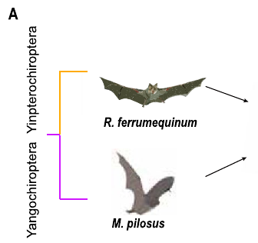
NEUR 411 · NEUROETHOLOGY · FALL 2026
Lecture 16
Bat echolocation I:
CF-FM bats and Doppler-shift compensation (Suga)
Wednesday, September 30, 2026
Jordan Lopez, Ph.D.
Professor of Neurobiology & Biomedical Engineering
Wang et al. (2025), Fig. 1(A). CF and FM study bats.
Notes:
Bat echolocation I: CF-FM bats and Doppler-shift compensation (Suga)
Lecture 16. NEUR 411 · NEUROETHOLOGY · FALL 2026. Wednesday, September 30, 2026.
Figure: Wang et al. (2025), Fig. 1(A). CF and FM study bats.
Figure source: https://doi.org/10.1111/1755-0998.14101

Slide 2
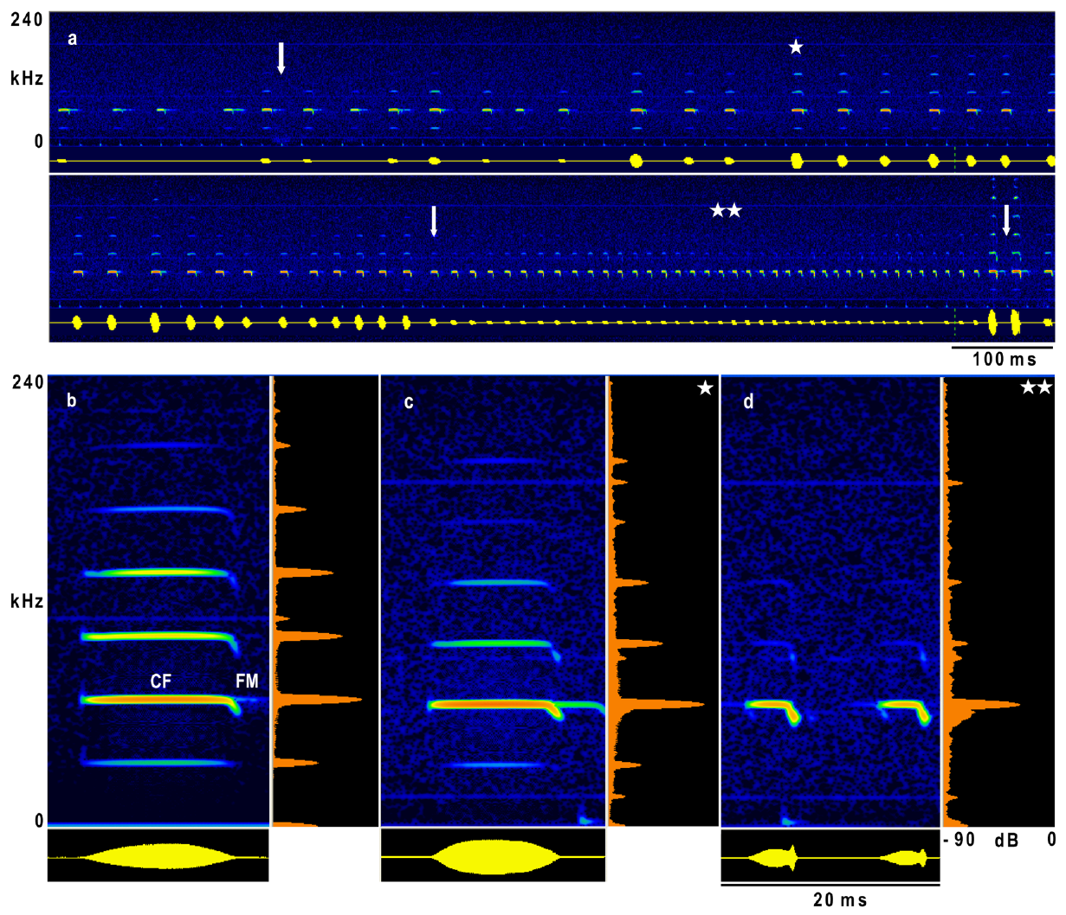
CF-FM calls combine a sustained tone and a short sweep
Echolocation is active sensing with emitted sounds and returning echoes. A constant-frequency component, or CF, maintains nearly one frequency; a frequency-modulated component, or FM, changes frequency during the signal. CF-FM bats combine a prolonged tone with a brief downward sweep.
In Hipposideros armiger, recordings during flight contain several harmonics, frequency components at integer multiples of the lowest component. The second harmonic carries the greatest amplitude. Its CF frequency is around 65–66 kHz in the animals studied by Schoeppler and colleagues.
The CF component persists during approach to a landing target, even as call duration and harmonic prominence change. A narrowband carrier and a changing terminal sweep therefore coexist within individual calls; the signal is not simply a pure tone.
Schoeppler et al. (2018), Fig. 1(a–d). Flight call sequence and CF-FM structure, in kHz and ms.
Schoeppler et al. (2018); Suga et al. (1975)
02
Notes:
• An echolocating bat supplies its own acoustic input by producing a call and receiving reflections. Constant frequency describes the sustained part of that call, whereas frequency modulation describes the brief change in frequency at its end.
• A harmonic belongs to a series of frequencies related by whole-number multiples. The second harmonic was the strongest component in these Hipposideros armiger recordings. Its frequency was near 65 to 66 kilohertz, which is above the human audible range.
• The recordings include stationary calling and flight toward a landing grid. The sustained component remained present during the final approach, although the calls became shorter and the higher harmonics weakened. The CF and FM labels describe acoustic components, not two separate calls.
References:
Schoeppler D, Schnitzler H-U, Denzinger A (2018). Precise Doppler shift compensation in the hipposiderid bat, Hipposideros armiger. Scientific Reports 8:4598. https://doi.org/10.1038/s41598-018-22880-y
Suga N, Simmons JA, Jen PH-S (1975). Peripheral specialization for fine analysis of Doppler-shifted echoes in the auditory system of the “CF-FM” bat Pteronotus parnellii. Journal of Experimental Biology 63(1):161–192. https://doi.org/10.1242/jeb.63.1.161
Figure: Schoeppler et al. (2018), Fig. 1(a–d). Flight call sequence and CF-FM structure, in kHz and ms.
Figure source: https://doi.org/10.1038/s41598-018-22880-y

Slide 3
Calls contain harmonics at whole-number multiples
A harmonic belongs to a series of frequencies related by whole-number multiples of the lowest component. A bat call can contain several harmonics at once, and the amplitude of each harmonic differs, so one harmonic can dominate the energy of the call.
In recordings of Hipposideros armiger during flight, the second harmonic carried the greatest amplitude, with a constant-frequency component near 65–66 kHz, above the human audible range. Schoeppler and colleagues recorded stationary calling and flight toward a landing grid.
The sustained CF component remained present during the final approach, although the calls became shorter and the higher harmonics weakened. The CF and FM labels describe acoustic components of one call, so a narrowband carrier and a changing terminal sweep coexist within individual calls.
Schoeppler et al. (2018), Fig. 1(a–d). Flight call sequence and CF-FM structure, in kHz and ms.
Schoeppler et al. (2018); Suga et al. (1975)
02a
Notes:
• A call is a sound with several frequency components, and the labels CF and FM name parts of one call and do not name two calls.
• Harmonics.
– A harmonic belongs to a series of frequencies related by whole-number multiples.
– The second harmonic was the strongest component in the Hipposideros armiger recordings.
• Where the frequencies lie.
– The second-harmonic CF component was near 65 to 66 kilohertz.
– That frequency is above the human audible range.
• Call structure during approach.
– The sustained component remained present during the final approach.
– The calls became shorter and the higher harmonics weakened.
• CF and FM labels.
– Constant frequency describes the sustained part of the call, and frequency modulation describes the brief change in frequency at its end.
– The labels describe acoustic components of one call.
• Why one harmonic dominates.
– Each harmonic in a call has its own amplitude, so energy is not shared equally across the series.
– In the flight recordings the second harmonic carried the most energy.
• Reading the numbers.
– A frequency near 65 to 66 kilohertz lies above what humans hear, so the call is inaudible to us even when it is intense.
References:
Schoeppler D, Schnitzler H-U, Denzinger A (2018). Precise Doppler shift compensation in the hipposiderid bat, Hipposideros armiger. Scientific Reports 8:4598. https://doi.org/10.1038/s41598-018-22880-y
Suga N, Simmons JA, Jen PH-S (1975). Peripheral specialization for fine analysis of Doppler-shifted echoes in the auditory system of the “CF-FM” bat Pteronotus parnellii. Journal of Experimental Biology 63(1):161–192. https://doi.org/10.1242/jeb.63.1.161

Slide 4
Flutter changes the echoes carried by the CF component
Flutter is the periodic motion of an insect’s wings. Flutter-detecting bats receive echoes whose amplitude and frequency vary as the reflecting wings move. The long CF component supplies a sustained carrier on which those changes can occur.
The auditory fovea is an expanded, sharply tuned representation of a narrow frequency range in the hearing system. In CF-FM bats, that range corresponds closely to the returning CF component rather than to all ultrasonic frequencies equally.
Flight-induced shifts can move the echo carrier away from this specialized range. Doppler-shift compensation keeps echoes from stationary targets ahead near the preferred frequency, supporting analysis of smaller variations associated with flutter. The behavioral adjustment and peripheral specialization are complementary adaptations.
Schoeppler et al. (2018), Fig. 1(a–d). Flight call sequence and CF-FM structure, in kHz and ms.
Schoeppler et al. (2018); Suga et al. (1975)
03
Notes:
• An insect wing changes position and orientation repeatedly during a wingbeat. The resulting echo can change in both amplitude and frequency. A long constant-frequency call provides a carrier whose fluctuations can be resolved by a hearing system specialized for that band.
• The term auditory fovea refers to unequal representation: a narrow range of frequencies receives unusually fine tuning and extensive representation. It does not mean that the ear is equally sensitive to every part of an ultrasonic call.
• Self-motion also changes echo frequency, even when the reflecting object is stationary. Compensation reduces that large shift of the carrier. It does not require the bat to remove every smaller fluctuation produced by a moving wing. Suga’s peripheral recordings and the flight observations address different parts of this combined sensory strategy.
References:
Schoeppler D, Schnitzler H-U, Denzinger A (2018). Precise Doppler shift compensation in the hipposiderid bat, Hipposideros armiger. Scientific Reports 8:4598. https://doi.org/10.1038/s41598-018-22880-y
Suga N, Simmons JA, Jen PH-S (1975). Peripheral specialization for fine analysis of Doppler-shifted echoes in the auditory system of the “CF-FM” bat Pteronotus parnellii. Journal of Experimental Biology 63(1):161–192. https://doi.org/10.1242/jeb.63.1.161
Figure: Schoeppler et al. (2018), Fig. 1(a–d). Flight call sequence and CF-FM structure, in kHz and ms.
Figure source: https://doi.org/10.1038/s41598-018-22880-y

Slide 5
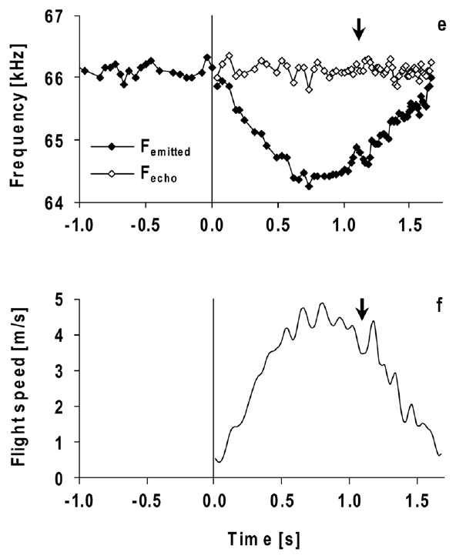
Approaching a reflector raises returning echo frequency
A Doppler shift is a frequency change caused by relative motion between a sound source, a reflector, and a receiver. When a bat approaches a stationary object, the returning echo has a higher frequency than the emitted sound.
Doppler-shift compensation lowers the frequency of subsequent calls as approaching motion raises echo frequency. The regulated quantity is the returning CF frequency. The emitted CF frequency must therefore change rather than remain fixed throughout flight.
Schoeppler and colleagues recorded calls and reconstructed flight toward a grid. Call frequency fell during acceleration and recovered during deceleration. Schuller and colleagues independently manipulated echo frequency in stationary bats, separating an auditory-feedback effect from the mechanical effects of flight.
Schoeppler et al. (2018), Fig. 2(e–f). Measured emission and flight speed, with calculated echo frequency.
Schuller et al. (1974); Schoeppler et al. (2018)
04
Notes:
• A stationary reflector can return a frequency-shifted echo when the bat itself is moving. Motion toward the reflector raises the returning frequency. The bat counters this by lowering the frequency it emits on later calls.
• Compensation is an adjustment of the outgoing signal based on the returning signal. The bat can maintain a relatively stable echo frequency while producing a sequence of calls whose frequencies differ substantially.
• Free-flight recordings connect the adjustment to natural movement, but movement also changes distance, echo intensity, and other conditions. Artificial-echo playback provides a separate causal test. A stationary animal changes its call frequency when only the frequency of its acoustic feedback is altered, establishing that physical acceleration is not required to evoke the response.
References:
Schuller G, Beuter K, Schnitzler H-U (1974). Response to frequency shifted artificial echoes in the bat Rhinolophus ferrumequinum. Journal of Comparative Physiology 89(3):275–286. https://doi.org/10.1007/BF00696191
Schoeppler D, Schnitzler H-U, Denzinger A (2018). Precise Doppler shift compensation in the hipposiderid bat, Hipposideros armiger. Scientific Reports 8:4598. https://doi.org/10.1038/s41598-018-22880-y
Figure: Schoeppler et al. (2018), Fig. 2(e–f). Measured emission and flight speed, with calculated echo frequency.
Figure source: https://doi.org/10.1038/s41598-018-22880-y

Slide 6
Approach raises echo frequency
A Doppler shift is a change in frequency caused by relative motion between a sound source, a reflector and a receiver. When a bat approaches a stationary object, the returning echo has a higher frequency than the emitted call, because the bat's own motion changes the frequency that it receives.
The bat counters the shift by lowering the frequency of its later calls, so the returning CF frequency is the regulated quantity. The emitted CF frequency therefore changes during flight, and the bat can maintain a relatively stable echo frequency while producing calls whose frequencies differ substantially.
Schoeppler and colleagues reconstructed flight toward a grid, and call frequency fell during acceleration and recovered during deceleration. Schuller and colleagues changed only the frequency of the echo in stationary bats, which separates an effect of auditory feedback from the mechanical effects of flight.
Schoeppler et al. (2018), Fig. 2(e–f). Measured emission and flight speed, with calculated echo frequency.
Schuller et al. (1974); Schoeppler et al. (2018)
04a
Notes:
• Compensation is an adjustment of the outgoing call based on the returning echo, and playback separates that feedback from the movement of the body.
• Self-motion changes echo frequency.
– A stationary reflector can return a frequency-shifted echo when the bat itself is moving.
– Motion toward the reflector raises the returning frequency.
• The adjustment.
– The bat lowers the frequency it emits on later calls.
– The echo frequency is therefore held relatively stable while the emitted frequency changes.
• Evidence from flight.
– Free-flight recordings connect the adjustment to natural movement.
– Movement also changes distance and echo intensity, so flight alone does not isolate frequency feedback.
• Evidence from playback.
– A stationary animal changes its call frequency when only the frequency of its acoustic feedback is altered.
– Physical acceleration is therefore not required to evoke the response.
• Direction of the shift.
– Approaching a stationary object raises the echo frequency above the emitted frequency.
– The bat lowers later calls so that the returning frequency stays relatively stable.
• Two experimental routes.
– Flight reconstruction followed call frequency during acceleration and deceleration.
– Playback to stationary bats changed only the echo, which separates auditory feedback from the mechanical effects of flight.
References:
Schuller G, Beuter K, Schnitzler H-U (1974). Response to frequency shifted artificial echoes in the bat Rhinolophus ferrumequinum. Journal of Comparative Physiology 89(3):275–286. https://doi.org/10.1007/BF00696191
Schoeppler D, Schnitzler H-U, Denzinger A (2018). Precise Doppler shift compensation in the hipposiderid bat, Hipposideros armiger. Scientific Reports 8:4598. https://doi.org/10.1038/s41598-018-22880-y

Slide 7
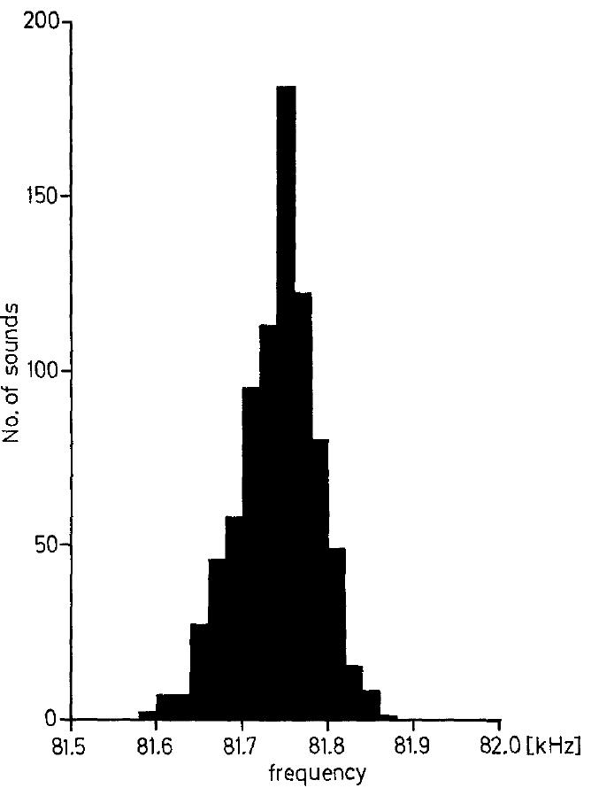
Resting frequency is an individual calling baseline
The resting frequency is the mean CF frequency of consecutive calls emitted by a stationary bat. In Schuller and colleagues’ greater horseshoe bats, Rhinolophus ferrumequinum, individual resting frequencies ranged from about 81 to 84.2 kHz.
The investigators measured the central CF portion, excluding the first and last 5 ms to avoid the adjoining FM sweeps. Repeated calls clustered closely around an individual’s baseline. Playing back unshifted calls did not systematically change that baseline.
Resting frequency is therefore a reference for describing changes in emitted frequency, not the frequency at which all compensated echoes must return. Individual and temporal differences require a baseline measured in the same animal and experimental period.
Schuller et al. (1974), Fig. 1. Distribution of CF frequencies in a stationary horseshoe bat.
Schuller et al. (1974)
05
Notes:
• The resting frequency is calculated from a series of calls made while the bat is stationary. It is an individual baseline, rather than a single frequency assigned to an entire species.
• These horseshoe bats called near 81 to 84.2 kilohertz. The measurements excluded the beginning and end of each call because those portions include frequency sweeps. The central sustained portion supplied the estimate of constant frequency.
• Unshifted playback controlled for the presence of an additional acoustic signal. It did not cause a systematic change in resting frequency. Frequency-shifted playback could therefore be compared against a baseline that was not simply altered by any echo presentation. The eventual frequency of a compensated echo must still be distinguished from this emission baseline.
References:
Schuller G, Beuter K, Schnitzler H-U (1974). Response to frequency shifted artificial echoes in the bat Rhinolophus ferrumequinum. Journal of Comparative Physiology 89(3):275–286. https://doi.org/10.1007/BF00696191
Figure: Schuller et al. (1974), Fig. 1. Distribution of CF frequencies in a stationary horseshoe bat.
Figure source: https://doi.org/10.1007/BF00696191

Slide 8
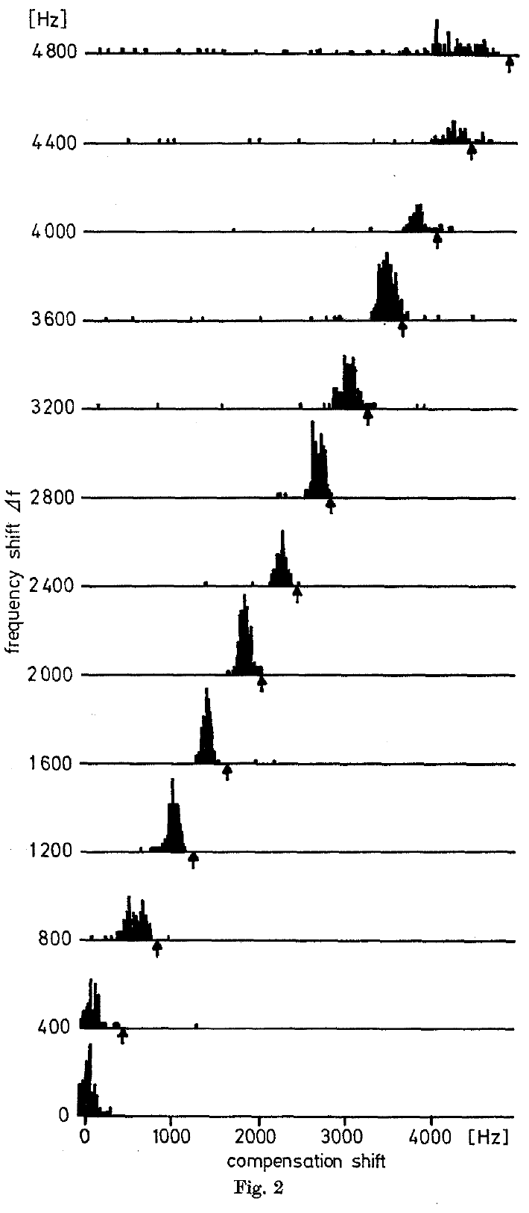
Shifted playback causes subsequent calls to fall in pitch
Schuller and colleagues returned each horseshoe bat’s own call through an electronic frequency shifter. The stationary animal could move its head, but it did not fly. The microphone and loudspeaker were positioned 34 cm in front of it.
When the artificial echo was shifted upward, later emitted calls decreased in CF frequency. After several calls, the animal reached a new emission level. Increasing the imposed positive shift required progressively greater lowering of the outgoing frequency.
This closed-loop playback preserves the link between the animal’s current call and its feedback. The compensation response depends on an experimentally imposed frequency discrepancy, rather than requiring actual motion toward a reflector.
Schuller et al. (1974), Fig. 2. Emission-frequency compensation under increasing positive echo shifts, in Hz.
Schuller et al. (1974)
06
Notes:
• The returning sound was made from the bat’s own vocalization. Its frequency was changed electronically and it was played back to the animal. As the animal changed its next call, the playback changed with that call while retaining the imposed shift.
• The horseshoe bat remained stationary. An upward change in playback frequency nevertheless caused it to lower subsequent emissions. The response settled after a short sequence of calls, rather than being a fixed change caused by a single prerecorded tone.
• The intervention establishes an auditory contribution to frequency control. It does not identify the neurons that compare feedback with a preferred frequency, and it does not recreate every property of a naturally moving target. Natural Doppler shifts and an electronic shift can differ in how they affect the frequency-modulated parts of a call.
References:
Schuller G, Beuter K, Schnitzler H-U (1974). Response to frequency shifted artificial echoes in the bat Rhinolophus ferrumequinum. Journal of Comparative Physiology 89(3):275–286. https://doi.org/10.1007/BF00696191
Figure: Schuller et al. (1974), Fig. 2. Emission-frequency compensation under increasing positive echo shifts, in Hz.
Figure source: https://doi.org/10.1007/BF00696191

Slide 9
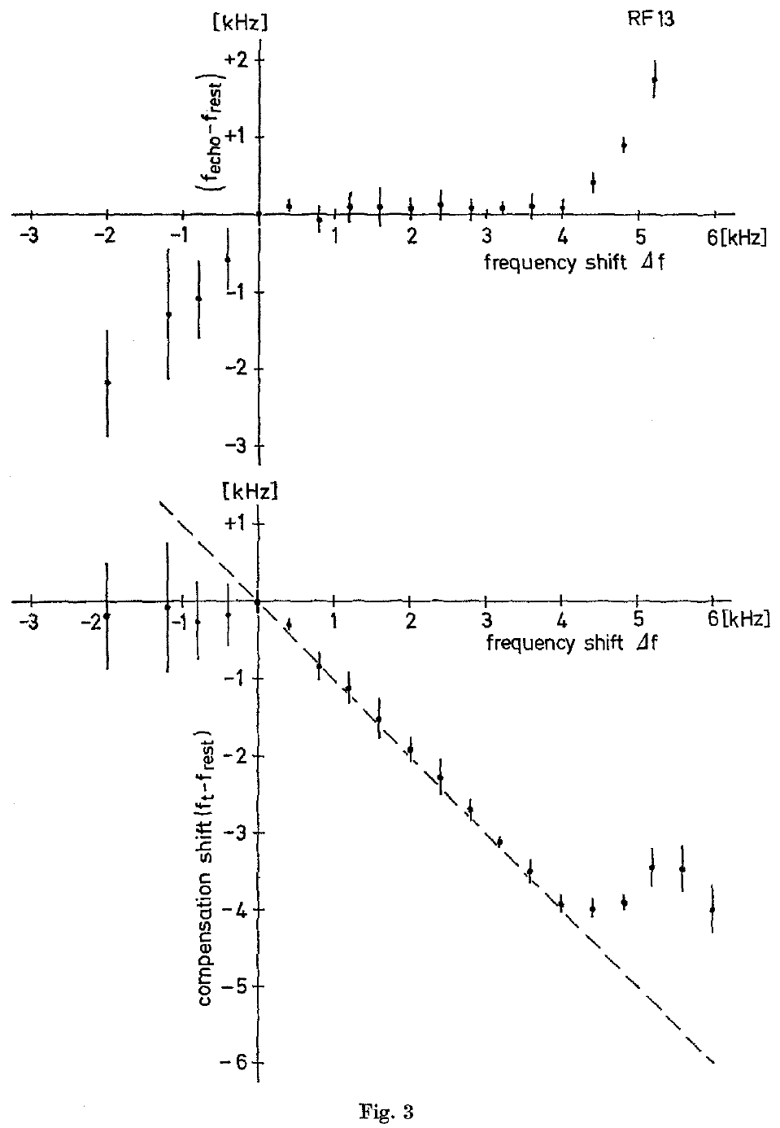
Compensated echoes sit slightly above resting frequency
The reference frequency is the returning CF frequency maintained during compensation. In Schuller and colleagues’ experiments, the downward change in emission was slightly smaller than the upward shift imposed on the artificial echo.
The resulting echo therefore remained above resting frequency. This compensation offset, the difference between reference and resting frequencies, was approximately 50–300 Hz across the bats studied and stayed relatively constant across an individual’s compensation range.
Compensation controls the returning echo near an individual reference frequency, which lies slightly above the resting frequency. An emission change and an echo-frequency error are different measurements, so a bat can make a large downward change in emitted frequency and still keep a small positive offset in its feedback.
Schuller et al. (1974), Fig. 3. Echo-frequency offset and emission compensation across imposed shifts, in kHz.
Schuller et al. (1974)
07
Notes:
• An artificial echo combines the bat’s current emitted frequency with the shift added by the playback apparatus. Lowering emission by slightly less than that added shift leaves the returning echo slightly above the resting baseline.
• The authors called the stabilized returning frequency the reference frequency. The offset between this reference and resting frequency was about 50 to 300 hertz, depending on the animal. Within an animal, that offset remained similar as the imposed shift increased.
• An emission change and an echo-frequency error are different measurements. A bat can make a large downward change in emitted frequency and still retain a small positive offset in feedback. The regulated echo band is therefore not identical to the average call frequency measured at rest.
References:
Schuller G, Beuter K, Schnitzler H-U (1974). Response to frequency shifted artificial echoes in the bat Rhinolophus ferrumequinum. Journal of Comparative Physiology 89(3):275–286. https://doi.org/10.1007/BF00696191
Figure: Schuller et al. (1974), Fig. 3. Echo-frequency offset and emission compensation across imposed shifts, in kHz.
Figure source: https://doi.org/10.1007/BF00696191

Slide 10
Resting and reference frequencies differ
The resting frequency is the mean CF frequency of consecutive calls from a stationary bat, and the reference frequency is the returning CF frequency maintained during compensation. They are two different baselines, one defined by the call that is emitted and the other by the echo that is received.
In Schuller and colleagues' experiments, the downward change in emission was slightly smaller than the upward shift imposed on the artificial echo, so the echo remained above the resting frequency. This compensation offset was approximately 50–300 Hz across the bats and stayed relatively constant across an individual's compensation range.
An emission change and an echo-frequency error are different measurements. A bat can make a large downward change in emitted frequency and still keep a small positive offset in its feedback, so the regulated echo band differs from the average call frequency measured at rest.
Schuller et al. (1974), Fig. 3. Echo-frequency offset and emission compensation across imposed shifts, in kHz.
Schuller et al. (1974)
07a
Notes:
• Two baselines describe the same bat, one for what it emits and one for what it hears, and comparing them requires the same animal and the same time.
• Resting frequency.
– It is calculated from a series of calls made while the bat is stationary.
– It is an individual baseline, not a single frequency for the entire species.
• Reference frequency.
– The authors called the stabilized returning frequency the reference frequency.
– It lies slightly above the resting frequency.
• Why the offset exists.
– An artificial echo combines the emitted frequency with the shift added by the apparatus.
– Lowering emission by slightly less than the added shift leaves the echo slightly above the resting baseline.
• Size of the offset.
– The offset was about 50 to 300 hertz depending on the animal and stayed similar across the imposed shifts within an animal.
• Two baselines.
– The resting frequency is defined from the call that is emitted, and the reference frequency is defined from the echo that is received.
– Keeping them separate prevents an emission change from being read as an echo error.
• Size of the offset.
– The compensation offset was approximately 50 to 300 hertz across bats and stayed relatively constant within an individual.
References:
Schuller G, Beuter K, Schnitzler H-U (1974). Response to frequency shifted artificial echoes in the bat Rhinolophus ferrumequinum. Journal of Comparative Physiology 89(3):275–286. https://doi.org/10.1007/BF00696191

Slide 11
Early playback tests found little response to lower echoes
In the 1974 experiments, downward shifts of artificial echoes did not evoke a systematic increase in emitted frequency. The bats continued calling near resting frequency, although their calls became somewhat less regular in frequency.
This finding supported an initially asymmetric account: echoes above the reference band lowered emission, whereas echoes below it appeared ineffective. However, the intensity dependence of the response was not systematically measured in that study.
Metzner and colleagues later tested feedback above and below resting frequency at comparable levels above hearing threshold. Frequency and audibility are coupled in a sharply tuned hearing system, so a sound below the most sensitive band may have to be much louder to be equally audible, and the historical difference reflects a change in experimental conditions and interpretation.
Schuller et al. (1974), Fig. 2. Emission-frequency compensation under increasing positive echo shifts, in Hz.
Schuller et al. (1974); Metzner et al. (2002)
08
Notes:
• The original playback experiments produced a clear decrease in emission for positive shifts, but did not produce a comparable increase for negative shifts. That result described behavior under the tested conditions.
• Frequency and audibility are coupled in a sharply tuned hearing system. A sound below the most sensitive band may have to be much louder to be equally audible. Comparing feedback at the same physical sound level is therefore not necessarily comparing equal auditory stimulation.
• The later study controlled playback level relative to hearing threshold. Under those conditions, lower-frequency echoes did raise emitted frequency. The historical difference is a change in experimental conditions and interpretation, rather than evidence that the bat’s nervous system acquired a new ability between studies.
References:
Schuller G, Beuter K, Schnitzler H-U (1974). Response to frequency shifted artificial echoes in the bat Rhinolophus ferrumequinum. Journal of Comparative Physiology 89(3):275–286. https://doi.org/10.1007/BF00696191
Metzner W, Zhang S, Smotherman M (2002). Doppler-shift compensation behavior in horseshoe bats revisited: auditory feedback controls both a decrease and an increase in call frequency. Journal of Experimental Biology 205(11):1607–1616. https://doi.org/10.1242/jeb.205.11.1607
Figure: Schuller et al. (1974), Fig. 2. Emission-frequency compensation under increasing positive echo shifts, in Hz.
Figure source: https://doi.org/10.1007/BF00696191

Slide 12
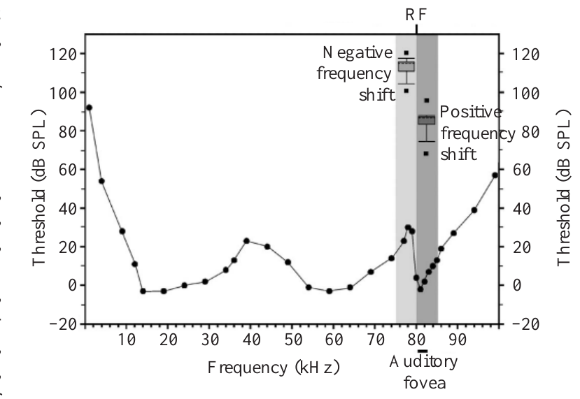
Equal sound levels need not produce equal audibility
An audiogram relates sound frequency to the minimum level required for detection. The horseshoe bat’s auditory fovea has a low threshold near its preferred echo band, with substantially poorer sensitivity at some lower frequencies.
Sound pressure level, or dB SPL, describes physical sound amplitude. Sensation level describes how far a sound lies above the hearing threshold at its frequency. Equal dB SPL values can correspond to different sensation levels.
Metzner and colleagues delivered positive and negative frequency shifts at approximately comparable suprathreshold levels. Lower-frequency feedback required louder playback. This control separated the sign of a frequency shift from the reduction in audibility that otherwise accompanies a shift away from the fovea.
Metzner et al. (2002), Fig. 1. Auditory thresholds and playback ranges; audiogram credited in the paper to Long and Schnitzler (1975).
Metzner et al. (2002); Long & Schnitzler (1975)
09
Notes:
• An audiogram is a frequency-by-frequency measure of detection threshold. A low threshold means that a relatively weak sound can be detected. The narrow sensitive band in a horseshoe bat makes the relation between physical intensity and audibility strongly dependent on frequency.
• Sound pressure level measures the sound itself. Sensation level expresses that sound relative to the threshold at the tested frequency. A playback below the sensitive band can require a higher sound pressure level to achieve comparable auditory stimulation.
• The experiment therefore adjusted intensity as well as frequency. Comparing sufficiently audible feedback on both sides of resting frequency tested whether lower-frequency information could participate in call control. The audiogram reproduced in the article supplies the threshold context; the compensation measurements are the study’s behavioral intervention.
References:
Metzner W, Zhang S, Smotherman M (2002). Doppler-shift compensation behavior in horseshoe bats revisited: auditory feedback controls both a decrease and an increase in call frequency. Journal of Experimental Biology 205(11):1607–1616. https://doi.org/10.1242/jeb.205.11.1607
Long GR, Schnitzler H-U (1975). Behavioural audiograms from the bat, Rhinolophus ferrumequinum. Journal of Comparative Physiology 100:211–219. https://doi.org/10.1007/BF00614531
Figure: Metzner et al. (2002), Fig. 1. Auditory thresholds and playback ranges; audiogram credited in the paper to Long and Schnitzler (1975).
Figure source: https://doi.org/10.1242/jeb.205.11.1607

Slide 13
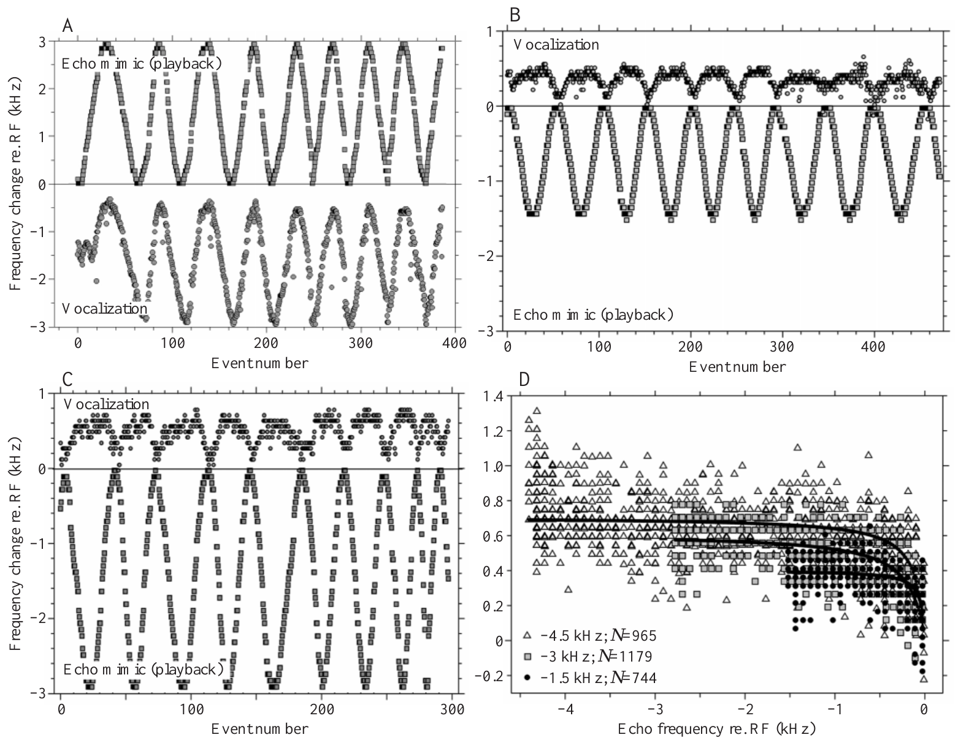
Audible lower-frequency echoes raise emitted frequency
Metzner and colleagues sinusoidally varied the frequency of feedback made from each bat’s own call. A sinusoidal modulation is a repeated smooth rise and fall. Feedback shifts extended above or below the animal’s resting frequency.
Positive shifts caused emitted frequency to decrease. At sufficient playback levels, negative shifts caused emitted frequency to increase above resting frequency. The opposite changes followed the changing frequency of the artificial echo.
The vocal system therefore receives useful feedback from both sides of the resting band. This two-direction response contradicts an explanation in which lower-frequency echoes have no influence on call frequency. The presence of an upward vocal correction establishes that feedback below the resting frequency can influence the control system, and the correction in that direction remained smaller.
Metzner et al. (2002), Fig. 2(A–D). Call and playback changes for positive and negative frequency shifts.
Metzner et al. (2002)
10
Notes:
• The playback shift changed gradually and repeatedly rather than remaining at a single value. The animal heard an echo mimic whose frequency depended on its current call and the experimentally imposed modulation.
• When the echo mimic was shifted upward, the bat lowered emission. When it was shifted downward and presented loudly enough, the bat raised emission above its resting frequency. The change occurred systematically over repeated cycles of the imposed modulation.
• The presence of an upward vocal correction establishes that feedback below resting frequency can influence the control system. The amount of correction remained smaller in that direction. Sensory participation and compensation completeness are separate claims, and only the former is required to reject a strictly one-sided auditory-feedback account.
References:
Metzner W, Zhang S, Smotherman M (2002). Doppler-shift compensation behavior in horseshoe bats revisited: auditory feedback controls both a decrease and an increase in call frequency. Journal of Experimental Biology 205(11):1607–1616. https://doi.org/10.1242/jeb.205.11.1607
Figure: Metzner et al. (2002), Fig. 2(A–D). Call and playback changes for positive and negative frequency shifts.
Figure source: https://doi.org/10.1242/jeb.205.11.1607

Slide 14
Equal audibility tests the sign of the shift
A horseshoe bat's hearing is most sensitive in a narrow band near its preferred echo frequency, so the same physical sound level can be easily audible at one frequency and barely audible at another. Sensation level expresses how far a sound lies above the hearing threshold at its own frequency.
Early playback experiments found that downward shifts of artificial echoes did not systematically raise emitted frequency. Metzner and colleagues compared feedback above and below the resting frequency at comparable levels above hearing threshold, which required louder playback for the lower frequencies.
Under those conditions negative shifts did raise emitted frequency above the resting frequency, while positive shifts lowered it. The earlier asymmetry was therefore attributed to a difference in audibility between the two kinds of feedback, and lower-frequency echoes do take part in vocal control.
Metzner et al. (2002), Fig. 2(A–D). Call and playback changes for positive and negative frequency shifts.
Metzner et al. (2002); Schuller et al. (1974)
10a
Notes:
• A fair test of upward and downward shifts matches how audible the feedback is, because sensitivity depends strongly on frequency.
• Audibility depends on frequency.
– The narrow sensitive band of a horseshoe bat means that a sound below that band may need to be much louder to be equally audible.
– Sound pressure level measures the sound itself and sensation level measures it relative to threshold.
• The matched comparison.
– Metzner and colleagues controlled playback level relative to hearing threshold.
– Feedback was shifted above and below the animal's resting frequency.
• The result.
– Upward shifts caused emitted frequency to decrease.
– Sufficiently audible downward shifts caused emitted frequency to increase above resting frequency.
• Change of interpretation.
– The historical difference is a change in experimental conditions and interpretation, and it does not reflect a new ability of the bat's nervous system between studies.
• Sensation level.
– Hearing is most sensitive in a narrow band near the preferred echo frequency, so equal sound pressure is not equally audible at different frequencies.
– Sensation level states how far a sound lies above threshold at its own frequency.
• Result of the comparison.
– Louder playback was needed for the lower frequencies.
– With that correction, negative shifts raised emitted frequency and positive shifts lowered it.
References:
Metzner W, Zhang S, Smotherman M (2002). Doppler-shift compensation behavior in horseshoe bats revisited: auditory feedback controls both a decrease and an increase in call frequency. Journal of Experimental Biology 205(11):1607–1616. https://doi.org/10.1242/jeb.205.11.1607
Schuller G, Beuter K, Schnitzler H-U (1974). Response to frequency shifted artificial echoes in the bat Rhinolophus ferrumequinum. Journal of Comparative Physiology 89(3):275–286. https://doi.org/10.1007/BF00696191

Slide 15
Upward vocal corrections are smaller than downward ones
In Metzner and colleagues’ playback experiments, bats compensated for roughly 95% of positive shifts but only up to about 22% of the range of negative shifts. Increasing emission above resting frequency was possible but comparatively limited.
A negative shift as large as 4.5 kHz produced a maximum observed emission increase of 1.51 kHz. Detecting feedback and generating a full motor correction therefore cannot be treated as the same capacity.
The authors related the asymmetry to restrictions on vocal production and discussed constraints involving the larynx. The vocal apparatus must convert an auditory correction into a change in the call, and the authors proposed that laryngeal constraints contribute to the smaller upward range. The experiment measured vocal output during playback.
Metzner et al. (2002), Fig. 2(A–D). Call and playback changes for positive and negative frequency shifts.
Metzner et al. (2002)
11
Notes:
• Compensation performance describes how much of the imposed frequency shift is countered by the bat’s emission change. The correction for positive shifts was much more complete than the correction for negative shifts.
• The reported comparison was approximately 95 percent versus up to 22 percent. In one negative-shift condition, a shift of 4.5 kilohertz produced a maximum emission increase of 1.51 kilohertz. The animal responded to the feedback without fully cancelling it.
• The vocal apparatus must convert an auditory correction into a change in the call. The authors proposed that laryngeal constraints contribute to the smaller upward range. The experiment itself measured vocal output during playback; it did not directly measure the mechanical limit of an isolated laryngeal muscle.
References:
Metzner W, Zhang S, Smotherman M (2002). Doppler-shift compensation behavior in horseshoe bats revisited: auditory feedback controls both a decrease and an increase in call frequency. Journal of Experimental Biology 205(11):1607–1616. https://doi.org/10.1242/jeb.205.11.1607
Figure: Metzner et al. (2002), Fig. 2(A–D). Call and playback changes for positive and negative frequency shifts.
Figure source: https://doi.org/10.1242/jeb.205.11.1607

Slide 16
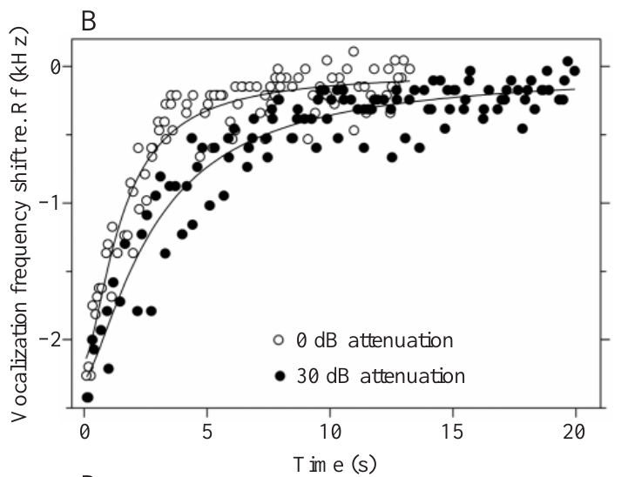
Louder feedback accelerates correction in both directions
Metzner and colleagues varied echo-mimic attenuation while maintaining stepwise frequency perturbations. Attenuation is a reduction in signal level. Stronger feedback produced faster vocal adjustment for both upward and downward corrections.
For recovery after a negative step, reported response time constants shortened from about 2.28 s at 30 dB attenuation to 0.89 s at zero attenuation. For positive steps, corresponding values shortened from about 1.64 s to 0.75 s.
The time constant describes the measured progress toward the adjusted call frequency. These differences require the control response to depend on feedback strength as well as frequency. The time constant was measured from the vocal trajectory as progress toward the final correction, so it describes the behavior of the entire feedback loop, which includes the strength of the returning acoustic signal.
Metzner et al. (2002), Fig. 3(B). Call-frequency recovery under strong and attenuated feedback, in seconds.
Metzner et al. (2002)
12
Notes:
• Attenuating an echo mimic by 30 decibels makes it weaker than the unattenuated playback. The study compared correction trajectories across different playback levels while controlling the imposed frequency change.
• Stronger feedback accelerated call-frequency recovery and accelerated the lowering response to a positive shift. The reported time constants were on the order of a second for the stronger conditions and longer for weaker feedback.
• The time constant was measured from the vocal trajectory, using the progress toward the final correction. It is not a directly measured conduction delay in a single neuron. The experiment constrains the behavior of the entire feedback loop and requires an account that includes the strength of the returning acoustic signal.
References:
Metzner W, Zhang S, Smotherman M (2002). Doppler-shift compensation behavior in horseshoe bats revisited: auditory feedback controls both a decrease and an increase in call frequency. Journal of Experimental Biology 205(11):1607–1616. https://doi.org/10.1242/jeb.205.11.1607
Figure: Metzner et al. (2002), Fig. 3(B). Call-frequency recovery under strong and attenuated feedback, in seconds.
Figure source: https://doi.org/10.1242/jeb.205.11.1607

Slide 17
A time constant measures progress toward correction
A time constant describes how quickly a response approaches its final value. For a vocal correction it is measured from the trajectory of the emitted frequency, as progress toward the adjusted call frequency, and a shorter time constant means a faster correction.
Metzner and colleagues varied the attenuation of the echo mimic, the reduction in its signal level, while applying stepwise frequency perturbations. For recovery after a negative step, the time constant shortened from about 2.28 s at 30 dB attenuation to 0.89 s with no attenuation, and for positive steps from about 1.64 s to 0.75 s.
Stronger feedback therefore produced faster correction in both directions. A rule that used only the sign of the frequency error, without regard for audibility, would not predict response speeds that depend on feedback strength.
Metzner et al. (2002), Fig. 3(B). Call-frequency recovery under strong and attenuated feedback, in seconds.
Metzner et al. (2002)
12a
Notes:
• The speed of correction measures how strongly the returning echo drives the vocal change.
• Reading a time constant.
– It is measured from the vocal trajectory as progress toward the final correction.
– It is not a conduction delay in a single neuron.
• Weaker feedback.
– Attenuating an echo mimic by 30 decibels makes it weaker than the unattenuated playback.
– Weaker feedback produced slower correction.
• The measured values.
– Recovery after a negative step shortened from about 2.28 s to 0.89 s as attenuation went from 30 dB to zero.
– For positive steps the corresponding values shortened from about 1.64 s to 0.75 s.
• What the result constrains.
– The result constrains the behavior of the whole feedback loop, which includes the strength of the returning acoustic signal.
• Reading a time constant.
– A time constant describes progress toward the final value, so a shorter value means that the call frequency reached its correction faster.
– It is measured from the trajectory of the emitted frequency.
• Attenuation and speed.
– Reducing the level of the echo mimic slowed recovery in both directions.
– Positive steps recovered from about 1.64 to 0.75 seconds as attenuation was removed.
References:
Metzner W, Zhang S, Smotherman M (2002). Doppler-shift compensation behavior in horseshoe bats revisited: auditory feedback controls both a decrease and an increase in call frequency. Journal of Experimental Biology 205(11):1607–1616. https://doi.org/10.1242/jeb.205.11.1607

Slide 18
Vocal correction is measured at the acoustic output
An auditory–vocal feedback experiment measures a sensory intervention and a change in emitted sound. Metzner and colleagues shifted echo frequency and varied playback intensity in stationary horseshoe bats. The acoustic output changed even without flight, establishing a feedback contribution to call-frequency control.
At comparable levels above hearing threshold, higher-frequency feedback lowered subsequent emissions and lower-frequency feedback raised them. Correction became faster as echoes became more audible. These measurements link an auditory discrepancy to a vocal adjustment but leave the intervening neural and muscular steps unresolved.
Its endpoint is a change in CF emission, measured in frequency and over time, so the acoustic output provides a precise readout of the feedback correction in stationary bats. Imaging the vocal apparatus or recording motor neurons addresses the steps between the auditory discrepancy and the vocal adjustment.
Metzner et al. (2002), Fig. 3(B). Call-frequency recovery under strong and attenuated feedback, in seconds.
Metzner et al. (2002)
13
Notes:
• An auditory–vocal feedback experiment measures a sensory intervention and a change in emitted sound. Metzner and colleagues shifted echo frequency and varied playback intensity in stationary horseshoe bats. The acoustic output changed even without flight, establishing a feedback contribution to call-frequency control.
• At comparable levels above hearing threshold, higher-frequency feedback lowered subsequent emissions and lower-frequency feedback raised them. Correction became faster as echoes became more audible. These measurements link an auditory discrepancy to a vocal adjustment but leave the intervening neural and muscular steps unresolved.
• Its endpoint is a change in CF emission, measured in frequency and over time, so the acoustic output provides a precise readout of the feedback correction in stationary bats. Imaging the vocal apparatus or recording motor neurons addresses the steps between the auditory discrepancy and the vocal adjustment.
References:
Metzner W, Zhang S, Smotherman M (2002). Doppler-shift compensation behavior in horseshoe bats revisited: auditory feedback controls both a decrease and an increase in call frequency. Journal of Experimental Biology 205(11):1607–1616. https://doi.org/10.1242/jeb.205.11.1607
Figure: Metzner et al. (2002), Fig. 3(B). Call-frequency recovery under strong and attenuated feedback, in seconds.
Figure source: https://doi.org/10.1242/jeb.205.11.1607

Slide 19
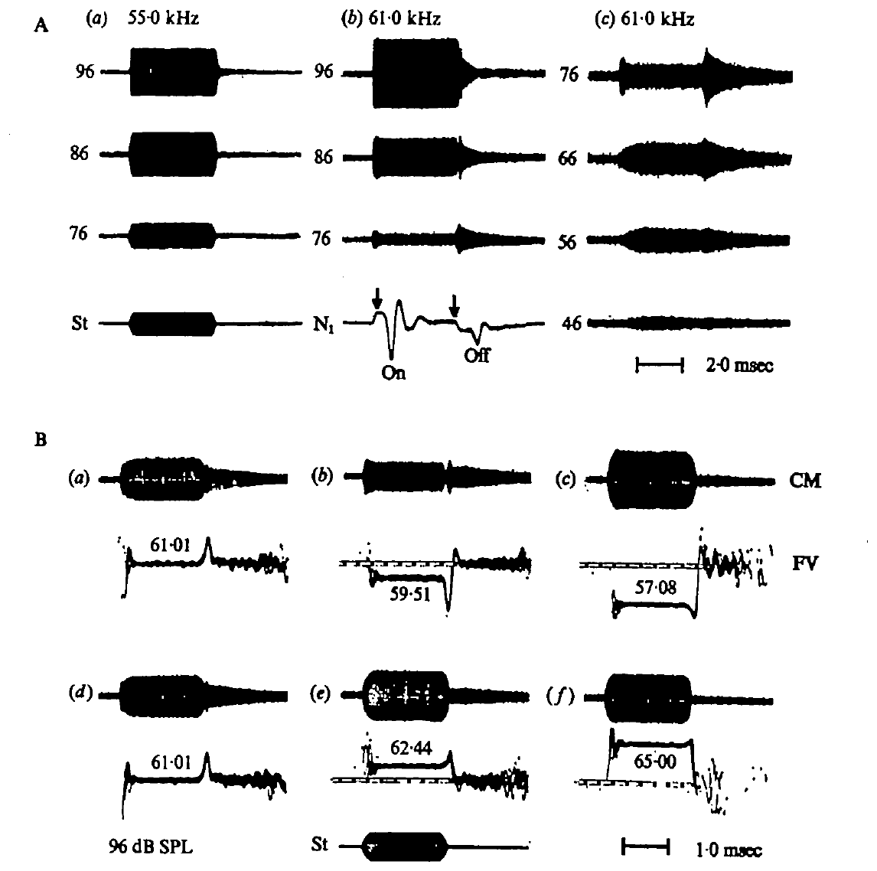
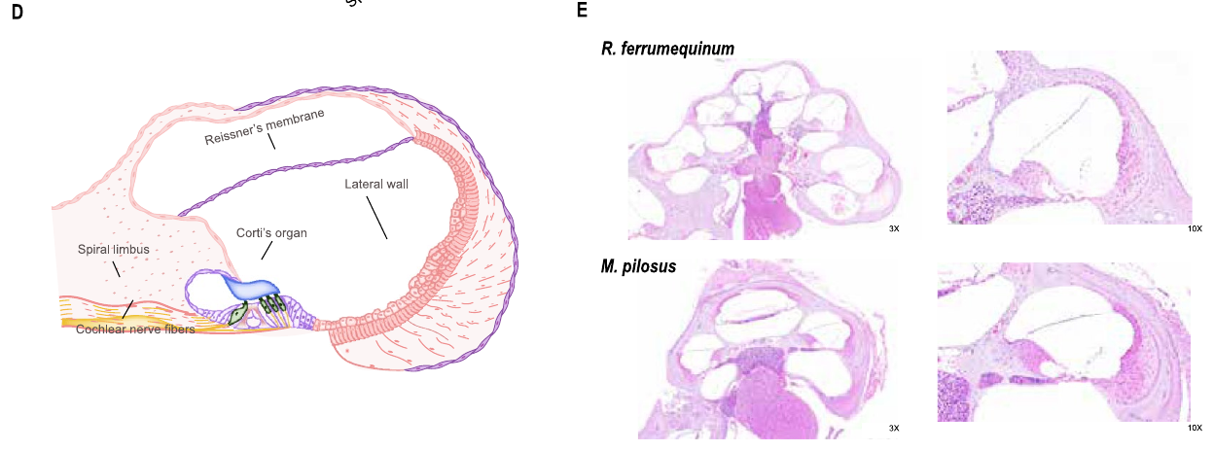
Cochlear recordings separate receptor and neural signals
The cochlea is the inner-ear structure that converts sound into receptor activity. Suga and colleagues recorded cochlear microphonics, or CM, electrical responses related to acoustic stimulation of the cochlea, using an electrode at the round window.
They also recorded the N1 response, summed activity of primary auditory neurons. CM and N1 therefore sampled different stages of peripheral processing: receptor-related activity and neural discharge. Tone bursts allowed the researchers to compare responses during sound and at its onset and cessation.
The paper’s short CM stimuli lasted 4 ms, with rapid rise and decay. Stimulus frequency and sound pressure were controlled at the ear. These recordings test whether narrow frequency selectivity and offset responses already arise peripherally, before a cortical interpretation of echo information.
Wang et al. (2025), Fig. 1(D–E). Published cochlear anatomy and stained tissue sections.
Suga et al. (1975), Fig. 1(A–B). Round-window cochlear and neural responses to calibrated tone bursts.
Suga et al. (1975); Wang et al. (2025)
14
Notes:
• The round window provides a recording site near the cochlea. The cochlear microphonic follows acoustic stimulation and is a receptor-related electrical signal; it is not a count of action potentials from one neuron.
• The N1 signal represents the summed activity of primary auditory neurons. Recording both signals allows a receptor-related transient to be compared with a transient in neural discharge. Their similarity can support a peripheral origin for a neural response, although the two measurements are not interchangeable.
• Suga and colleagues presented controlled tone bursts and calibrated their amplitude at the ear. Short bursts exposed onset and offset effects while reducing interference from the middle-ear muscle reflex. The frequency dependence of these effects supplied evidence about the sharply tuned mechanical properties of the inner ear.
References:
Suga N, Simmons JA, Jen PH-S (1975). Peripheral specialization for fine analysis of Doppler-shifted echoes in the auditory system of the “CF-FM” bat Pteronotus parnellii. Journal of Experimental Biology 63(1):161–192. https://doi.org/10.1242/jeb.63.1.161
Wang X, Bao M, Wang H, Sun R, Dai W, Sun K, Zhu Y, Pu Y, Chu Y, Li X, Wang T, Zhang M, Lin A, Li J, Feng J (2025). Cochlear Cell Atlas of Two Laryngeal Echolocating Bats—New Evidence for the Adaptive Nervous Physiology in Constant Frequency Bat. Molecular Ecology Resources 25:e14101. https://doi.org/10.1111/1755-0998.14101
Figure: Suga et al. (1975), Fig. 1(A–B). Round-window cochlear and neural responses to calibrated tone bursts.
Figure source: https://doi.org/10.1242/jeb.63.1.161
Figure: Wang et al. (2025), Fig. 1(D–E). Published cochlear anatomy and stained tissue sections.
Figure source: https://doi.org/10.1111/1755-0998.14101

Slide 20
Cochlear microphonic and N1 sample different stages
The cochlea is the inner-ear structure that converts sound into receptor activity. A cochlear microphonic, or CM, is an electrical response related to the acoustic stimulation of the cochlea, and N1 is the summed activity of primary auditory neurons.
Suga and colleagues recorded both with an electrode at the round window. CM samples receptor-related activity and N1 samples neural discharge, so comparing them locates a response in the receptor stage or the neural stage of peripheral processing.
The recordings used controlled tone bursts with calibrated amplitude at the ear, including 4-ms CM stimuli with rapid rise and decay. Short bursts expose responses at the onset and cessation of a tone and reduce interference from the middle-ear muscle reflex.
Wang et al. (2025), Fig. 1(D–E). Published cochlear anatomy and stained tissue sections.
Suga et al. (1975), Fig. 1(A–B). Round-window cochlear and neural responses to calibrated tone bursts.
Suga et al. (1975); Wang et al. (2025)
14a
Notes:
• Two electrical signals from the round window sample the receptor and the neural stages of the ear, and their comparison locates where a response arises.
• The recording site.
– The round window provides a recording site near the cochlea.
– The cochlear microphonic follows acoustic stimulation and is a receptor-related signal.
• The neural signal.
– N1 represents the summed activity of primary auditory neurons.
– Recording both allows a receptor-related transient to be compared with a transient in neural discharge.
• Controlled stimuli.
– Tone bursts were presented with amplitude calibrated at the ear.
– Short bursts expose onset and offset effects while reducing interference from the middle-ear muscle reflex.
• Interpretation.
– Similarity between CM and N1 can support a peripheral origin for a neural response, and the two measurements are not interchangeable.
• Round window recording.
– Both signals were recorded with an electrode at the round window, so the same site samples receptor-related and neural activity.
– Comparing CM and N1 places a response in the receptor stage or the neural stage.
• Stimulus design.
– Short tone bursts with rapid rise and decay expose onset and cessation responses.
– Brief stimuli also reduce interference from the middle-ear muscle reflex.
References:
Suga N, Simmons JA, Jen PH-S (1975). Peripheral specialization for fine analysis of Doppler-shifted echoes in the auditory system of the “CF-FM” bat Pteronotus parnellii. Journal of Experimental Biology 63(1):161–192. https://doi.org/10.1242/jeb.63.1.161
Wang X, Bao M, Wang H, Sun R, Dai W, Sun K, Zhu Y, Pu Y, Chu Y, Li X, Wang T, Zhang M, Lin A, Li J, Feng J (2025). Cochlear Cell Atlas of Two Laryngeal Echolocating Bats—New Evidence for the Adaptive Nervous Physiology in Constant Frequency Bat. Molecular Ecology Resources 25:e14101. https://doi.org/10.1111/1755-0998.14101

Slide 21
Cochlear anatomy links vibration to neural output
The cochlea is the coiled inner-ear structure that converts acoustic vibration into sensory activity. Wang and colleagues combined single-nucleus sequencing with hematoxylin-and-eosin tissue staining in the CF bat Rhinolophus ferrumequinum and the FM bat Myotis pilosus. Their published sections locate sensory tissue, neural tissue and the cochlear lateral wall.
The neurosensory epithelium contains hair cells and supporting cells. Hair cells provide the sensory interface; spiral ganglion neurons carry cochlear information toward the brainstem. The atlas resolved 14 cell types in the horseshoe bat and 13 in the FM bat, distinguishing several cooperating tissue compartments rather than treating the cochlea as one uniform population.
Anatomical localization and molecular classification describe where candidate mechanisms reside. The atlas provides a cellular framework for interpreting the peripheral specialization established by acoustic and electrophysiological experiments, with hair cells and supporting cells forming the sensory compartment and spiral ganglion neurons carrying cochlear information toward the brainstem.
Wang et al. (2025), Fig. 1(D–E). Published cochlear anatomy and stained tissue sections.
Wang et al. (2025)
15
Notes:
• The cochlea is the coiled inner-ear structure that converts acoustic vibration into sensory activity. Wang and colleagues combined single-nucleus sequencing with hematoxylin-and-eosin tissue staining in the CF bat Rhinolophus ferrumequinum and the FM bat Myotis pilosus. Their published sections locate sensory tissue, neural tissue and the cochlear lateral wall.
• The neurosensory epithelium contains hair cells and supporting cells. Hair cells provide the sensory interface; spiral ganglion neurons carry cochlear information toward the brainstem. The atlas resolved 14 cell types in the horseshoe bat and 13 in the FM bat, distinguishing several cooperating tissue compartments rather than treating the cochlea as one uniform population.
• Anatomical localization and molecular classification describe where candidate mechanisms reside. The atlas provides a cellular framework for interpreting the peripheral specialization established by acoustic and electrophysiological experiments, with hair cells and supporting cells forming the sensory compartment and spiral ganglion neurons carrying cochlear information toward the brainstem.
References:
Wang X, Bao M, Wang H, Sun R, Dai W, Sun K, Zhu Y, Pu Y, Chu Y, Li X, Wang T, Zhang M, Lin A, Li J, Feng J (2025). Cochlear Cell Atlas of Two Laryngeal Echolocating Bats—New Evidence for the Adaptive Nervous Physiology in Constant Frequency Bat. Molecular Ecology Resources 25:e14101. https://doi.org/10.1111/1755-0998.14101
Figure: Wang et al. (2025), Fig. 1(D–E). Published cochlear anatomy and stained tissue sections.
Figure source: https://doi.org/10.1111/1755-0998.14101

Slide 22
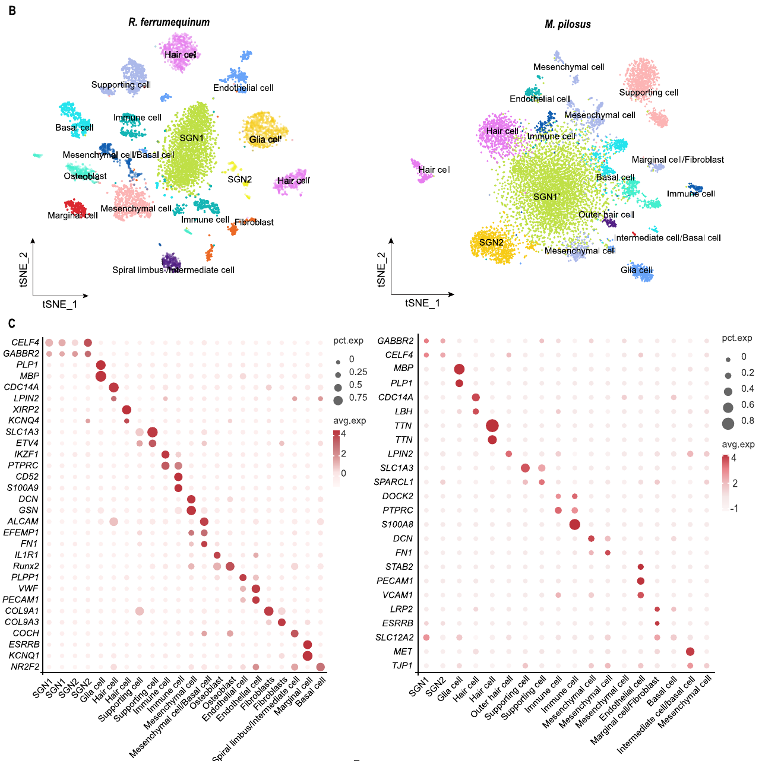
Nuclear RNA identifies distinct cochlear cell populations
Single-nucleus RNA sequencing measures RNA associated with individual cell nuclei. A marker gene helps identify a cell population by its expression pattern. Wang and colleagues grouped cochlear nuclei using expression profiles and used more than 200 marker genes to support the identification of neural, sensory, immune and structural populations.
Their species-specific analyses resolved 14 cell types in Rhinolophus ferrumequinum and 13 in Myotis pilosus. Neural populations included two spiral-ganglion categories and glial cells. Hair cells and supporting cells occupied the sensory compartment, while marginal and basal cells contributed to lateral-wall categories.
The plotted expression clusters are molecular groupings of nuclei. A cell's RNA profile identifies candidate functions, and a firing threshold, a preferred echo frequency or a contribution to vocal feedback would come from recordings of those cells.
Wang et al. (2025), Fig. 1(B–C). Cell clusters and original marker-expression matrix.
Wang et al. (2025)
16
Notes:
• Single-nucleus RNA sequencing measures RNA associated with individual cell nuclei. A marker gene helps identify a cell population by its expression pattern. Wang and colleagues grouped cochlear nuclei using expression profiles and used more than 200 marker genes to support the identification of neural, sensory, immune and structural populations.
• Their species-specific analyses resolved 14 cell types in Rhinolophus ferrumequinum and 13 in Myotis pilosus. Neural populations included two spiral-ganglion categories and glial cells. Hair cells and supporting cells occupied the sensory compartment, while marginal and basal cells contributed to lateral-wall categories.
• The plotted expression clusters are molecular groupings of nuclei. A cell's RNA profile identifies candidate functions, and a firing threshold, a preferred echo frequency or a contribution to vocal feedback would come from recordings of those cells.
References:
Wang X, Bao M, Wang H, Sun R, Dai W, Sun K, Zhu Y, Pu Y, Chu Y, Li X, Wang T, Zhang M, Lin A, Li J, Feng J (2025). Cochlear Cell Atlas of Two Laryngeal Echolocating Bats—New Evidence for the Adaptive Nervous Physiology in Constant Frequency Bat. Molecular Ecology Resources 25:e14101. https://doi.org/10.1111/1755-0998.14101
Figure: Wang et al. (2025), Fig. 1(B–C). Cell clusters and original marker-expression matrix.
Figure source: https://doi.org/10.1111/1755-0998.14101

Slide 23
Single-nucleus sequencing groups cells by RNA
Single-nucleus RNA sequencing measures the RNA associated with individual cell nuclei, so each nucleus has an expression profile. A marker gene helps identify a cell population by its expression pattern, and nuclei with similar profiles are grouped into one population.
Wang and colleagues grouped cochlear nuclei by expression and used more than 200 marker genes to identify neural, sensory, immune and structural populations. They resolved 14 cell types in the horseshoe bat Rhinolophus ferrumequinum and 13 in Myotis pilosus.
Neural populations included two spiral-ganglion categories and glial cells, hair cells and supporting cells occupied the sensory compartment, and marginal and basal cells contributed to the lateral wall. The plotted clusters are molecular groupings, and a firing threshold or preferred frequency would come from recordings of the cells.
Wang et al. (2025), Fig. 1(B–C). Cell clusters and original marker-expression matrix.
Wang et al. (2025)
16a
Notes:
• A cell atlas assigns identities from gene expression, and the identities name populations whose physiology is measured by other methods.
• From RNA to identity.
– Single-nucleus sequencing measures RNA associated with individual nuclei.
– A marker gene supports the identification of a cell population by its expression pattern.
• The populations.
– Neural populations included two spiral-ganglion categories and glial cells.
– Hair cells and supporting cells occupied the sensory compartment, and marginal and basal cells contributed to lateral-wall categories.
• Counts in the two species.
– The species-specific analyses resolved 14 cell types in Rhinolophus ferrumequinum and 13 in Myotis pilosus.
– More than 200 marker genes supported the identification of the populations.
• What the clusters represent.
– The plotted expression clusters are molecular groupings, not a map of cochlear position or of frequency tuning.
• Marker genes.
– A marker gene is expressed in a recognizable pattern, so it helps assign nuclei to a cell population.
– More than 200 marker genes were used to identify neural, sensory, immune and structural populations.
• Cell types by species.
– The analysis resolved 14 cell types in Rhinolophus ferrumequinum and 13 in Myotis pilosus.
– Hair cells and supporting cells occupied the sensory compartment, and marginal and basal cells contributed to the lateral wall.
References:
Wang X, Bao M, Wang H, Sun R, Dai W, Sun K, Zhu Y, Pu Y, Chu Y, Li X, Wang T, Zhang M, Lin A, Li J, Feng J (2025). Cochlear Cell Atlas of Two Laryngeal Echolocating Bats—New Evidence for the Adaptive Nervous Physiology in Constant Frequency Bat. Molecular Ecology Resources 25:e14101. https://doi.org/10.1111/1755-0998.14101

Slide 24
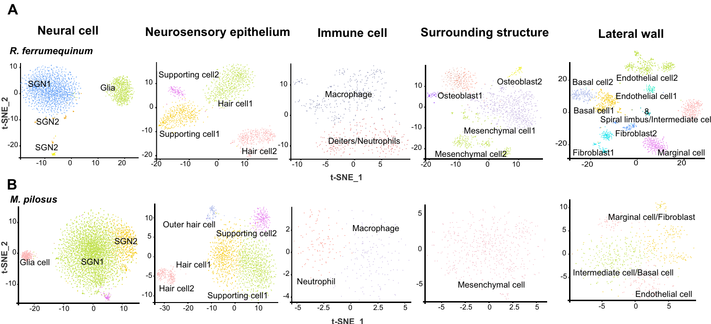
Spiral ganglion neurons carry peripheral auditory signals
Spiral ganglion neurons, or SGNs, are cochlear sensory neurons that convey auditory information toward the brainstem. Wang and colleagues distinguished SGN1 and SGN2 expression categories in both bats. These labels refer to molecular populations in this analysis rather than the onset and offset response categories measured by Suga.
The neural grouping was supported by expression of genes including CELF4 and GABBR2. Glial cells were identified using markers including MBP and PLP1. The same analysis separated hair cells and supporting cells from neural populations, allowing species differences to be assigned to particular tissue compartments.
The atlas found two principal SGN categories, whose labels describe molecular populations. Linking an RNA identity to recordings of individual tuning curves is what would assign a specific cell population an echo-frequency computation, so an association between a molecular category and narrowly tuned CF processing is a proposal.
Wang et al. (2025), Fig. 2(A–B). Classified neural and sensory populations.
Wang et al. (2025)
17
Notes:
• Spiral ganglion neurons, or SGNs, are cochlear sensory neurons that convey auditory information toward the brainstem. Wang and colleagues distinguished SGN1 and SGN2 expression categories in both bats. These labels refer to molecular populations in this analysis rather than the onset and offset response categories measured by Suga.
• The neural grouping was supported by expression of genes including CELF4 and GABBR2. Glial cells were identified using markers including MBP and PLP1. The same analysis separated hair cells and supporting cells from neural populations, allowing species differences to be assigned to particular tissue compartments.
• The atlas found two principal SGN categories, whose labels describe molecular populations. Linking an RNA identity to recordings of individual tuning curves is what would assign a specific cell population an echo-frequency computation, so an association between a molecular category and narrowly tuned CF processing is a proposal.
References:
Wang X, Bao M, Wang H, Sun R, Dai W, Sun K, Zhu Y, Pu Y, Chu Y, Li X, Wang T, Zhang M, Lin A, Li J, Feng J (2025). Cochlear Cell Atlas of Two Laryngeal Echolocating Bats—New Evidence for the Adaptive Nervous Physiology in Constant Frequency Bat. Molecular Ecology Resources 25:e14101. https://doi.org/10.1111/1755-0998.14101
Figure: Wang et al. (2025), Fig. 2(A–B). Classified neural and sensory populations.
Figure source: https://doi.org/10.1111/1755-0998.14101

Slide 25
Hair-cell markers locate candidate channel mechanisms
A hair cell is a sensory epithelial cell whose mechanically sensitive structures respond to displacement. In the atlas, expression of CDC14A, XIRP2, Kcnq4 and LBH helped identify hair-cell populations. KCNQ4 names a potassium-channel gene; detecting its RNA identifies a candidate cellular mechanism rather than measuring a potassium current.
Wang and colleagues separated sensory epithelial populations from spiral ganglion neurons and cochlear lateral-wall cells. Their 14-category horseshoe-bat atlas therefore places a channel-associated marker in a tissue context. Supporting-cell markers included SLC1A3, SPARCL1 and ETV4, emphasizing that sensory transduction depends on a multicellular environment.
KCNQ4 is a candidate cellular mechanism placed in a tissue context, and the molecular evidence complements peripheral recordings. Expressed genes, functional membrane currents and behavior are distinct levels of evidence, each measured by different experiments.
Wang et al. (2025), Fig. 2(A–B). Sensory and supporting-cell populations.
Wang et al. (2025)
18
Notes:
• A hair cell is a sensory epithelial cell whose mechanically sensitive structures respond to displacement. In the atlas, expression of CDC14A, XIRP2, Kcnq4 and LBH helped identify hair-cell populations. KCNQ4 names a potassium-channel gene; detecting its RNA identifies a candidate cellular mechanism rather than measuring a potassium current.
• Wang and colleagues separated sensory epithelial populations from spiral ganglion neurons and cochlear lateral-wall cells. Their 14-category horseshoe-bat atlas therefore places a channel-associated marker in a tissue context. Supporting-cell markers included SLC1A3, SPARCL1 and ETV4, emphasizing that sensory transduction depends on a multicellular environment.
• KCNQ4 is a candidate cellular mechanism placed in a tissue context, and the molecular evidence complements peripheral recordings. Expressed genes, functional membrane currents and behavior are distinct levels of evidence, each measured by different experiments.
References:
Wang X, Bao M, Wang H, Sun R, Dai W, Sun K, Zhu Y, Pu Y, Chu Y, Li X, Wang T, Zhang M, Lin A, Li J, Feng J (2025). Cochlear Cell Atlas of Two Laryngeal Echolocating Bats—New Evidence for the Adaptive Nervous Physiology in Constant Frequency Bat. Molecular Ecology Resources 25:e14101. https://doi.org/10.1111/1755-0998.14101
Figure: Wang et al. (2025), Fig. 2(A–B). Sensory and supporting-cell populations.
Figure source: https://doi.org/10.1111/1755-0998.14101

Slide 26
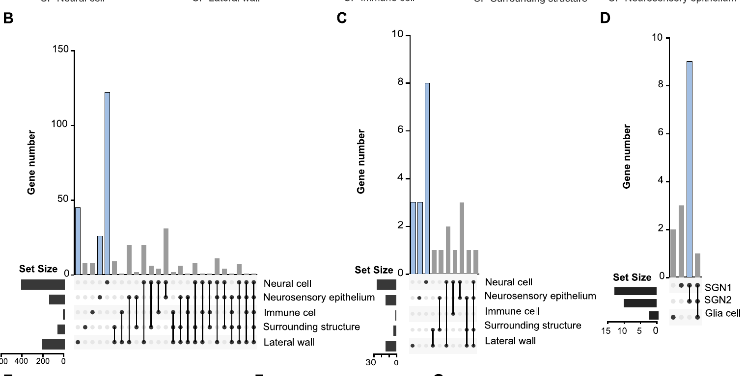
CF-associated expression is concentrated in neural cells
Differential expression describes a difference in measured gene abundance between comparison groups. Wang and colleagues mapped previously identified CF-associated gene sets onto their cochlear cell atlas. The mapped nervous-system-related genes were concentrated in neural cells, particularly the two spiral-ganglion categories.
The analysis localized a broader set of 1365 upregulated genes across neural cells, sensory epithelium and lateral-wall cells. It combined whole-tissue expression comparisons with single-nucleus localization, separating a cochlear-wide molecular signal into candidate cellular sources. These are expression measurements rather than recordings of acoustic responses.
Enrichment in SGN1 and SGN2 supports focused hypotheses about peripheral neural specialization. Differential expression describes a difference in measured gene abundance between comparison groups, and combining whole-tissue comparisons with single-nucleus localization separates a cochlear-wide molecular signal into candidate cellular sources.
Wang et al. (2025), Fig. 3(B–D). CF-associated genes across cell classes.
Wang et al. (2025)
19
Notes:
• Differential expression describes a difference in measured gene abundance between comparison groups. Wang and colleagues mapped previously identified CF-associated gene sets onto their cochlear cell atlas. The mapped nervous-system-related genes were concentrated in neural cells, particularly the two spiral-ganglion categories.
• The analysis localized a broader set of 1365 upregulated genes across neural cells, sensory epithelium and lateral-wall cells. It combined whole-tissue expression comparisons with single-nucleus localization, separating a cochlear-wide molecular signal into candidate cellular sources. These are expression measurements rather than recordings of acoustic responses.
• Enrichment in SGN1 and SGN2 supports focused hypotheses about peripheral neural specialization. Differential expression describes a difference in measured gene abundance between comparison groups, and combining whole-tissue comparisons with single-nucleus localization separates a cochlear-wide molecular signal into candidate cellular sources.
References:
Wang X, Bao M, Wang H, Sun R, Dai W, Sun K, Zhu Y, Pu Y, Chu Y, Li X, Wang T, Zhang M, Lin A, Li J, Feng J (2025). Cochlear Cell Atlas of Two Laryngeal Echolocating Bats—New Evidence for the Adaptive Nervous Physiology in Constant Frequency Bat. Molecular Ecology Resources 25:e14101. https://doi.org/10.1111/1755-0998.14101
Figure: Wang et al. (2025), Fig. 3(B–D). CF-associated genes across cell classes.
Figure source: https://doi.org/10.1111/1755-0998.14101

Slide 27
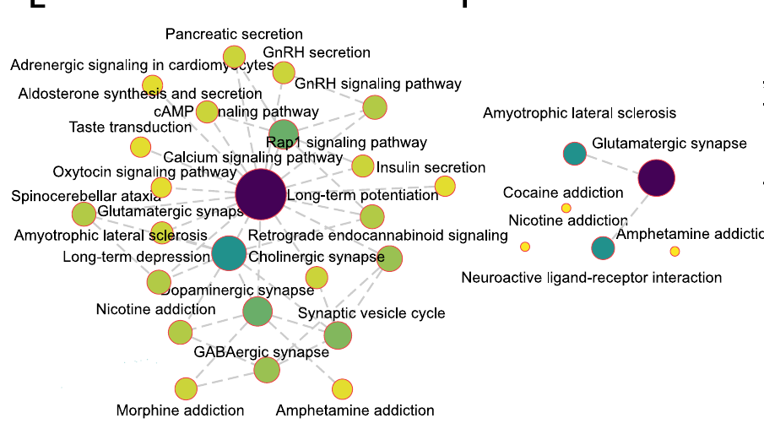
Calcium pathways are candidate components of CF tuning
Pathway enrichment asks whether a measured gene set contains many genes assigned to a biological process. In Wang and colleagues’ spiral-ganglion analysis, calcium signaling occupied a central position in the horseshoe-bat pathway network. The FM-bat comparison instead emphasized a glutamatergic-synapse pathway among its identified neural categories.
Calcium signaling refers to cellular processes regulated by calcium availability and calcium-sensitive proteins. A glutamatergic synapse uses glutamate-associated signaling between cells. The networks were constructed from gene-expression categories; their connections indicate relationships among annotated pathways, not demonstrated synaptic wiring.
The difference provides a molecular candidate for investigating CF-associated auditory specialization. Pathway networks are built from gene-expression categories, so their connections indicate relationships among annotated pathways, and calcium signaling occupies a central position in the horseshoe-bat network whereas the FM-bat comparison emphasizes a glutamatergic-synapse pathway.
Wang et al. (2025), Fig. 3(E–F). Published pathway networks from cochlear neural cells.
Wang et al. (2025)
20
Notes:
• Pathway enrichment asks whether a measured gene set contains many genes assigned to a biological process. In Wang and colleagues’ spiral-ganglion analysis, calcium signaling occupied a central position in the horseshoe-bat pathway network. The FM-bat comparison instead emphasized a glutamatergic-synapse pathway among its identified neural categories.
• Calcium signaling refers to cellular processes regulated by calcium availability and calcium-sensitive proteins. A glutamatergic synapse uses glutamate-associated signaling between cells. The networks were constructed from gene-expression categories; their connections indicate relationships among annotated pathways, not demonstrated synaptic wiring.
• The difference provides a molecular candidate for investigating CF-associated auditory specialization. Pathway networks are built from gene-expression categories, so their connections indicate relationships among annotated pathways, and calcium signaling occupies a central position in the horseshoe-bat network whereas the FM-bat comparison emphasizes a glutamatergic-synapse pathway.
References:
Wang X, Bao M, Wang H, Sun R, Dai W, Sun K, Zhu Y, Pu Y, Chu Y, Li X, Wang T, Zhang M, Lin A, Li J, Feng J (2025). Cochlear Cell Atlas of Two Laryngeal Echolocating Bats—New Evidence for the Adaptive Nervous Physiology in Constant Frequency Bat. Molecular Ecology Resources 25:e14101. https://doi.org/10.1111/1755-0998.14101
Figure: Wang et al. (2025), Fig. 3(E–F). Published pathway networks from cochlear neural cells.
Figure source: https://doi.org/10.1111/1755-0998.14101

Slide 28
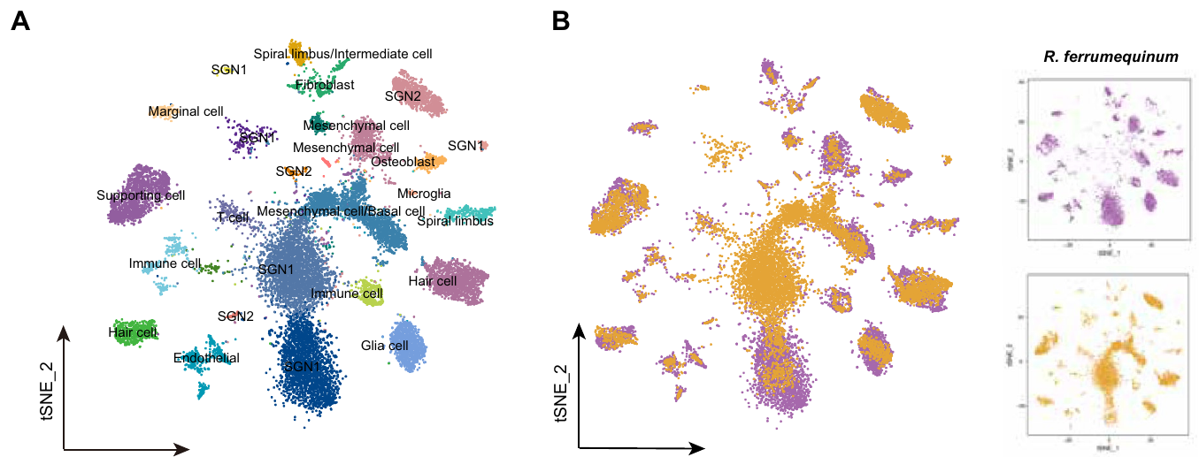
Orthologous genes permit a controlled species comparison
Orthologous genes are corresponding genes in different species inherited from a common ancestral gene. Wang and colleagues used 8607 orthologous genes to construct a joint cochlear atlas for Rhinolophus ferrumequinum and Myotis pilosus. This provides a common comparison space rather than comparing unrelated species-specific marker lists.
The joint analysis resolved 26 expression clusters and assigned familiar cochlear identities, including SGNs, glial cells, supporting cells and hair cells. Some clusters were dominated by one species, while others contained contributions from both. The separation preserves both shared cellular organization and species-associated expression differences.
A shared gene framework improves comparability by giving the two species a common comparison space. The joint analysis separates shared cellular organization from species-associated expression differences, and a CF-associated expression pattern is a candidate adaptation to be tested with wider comparative sampling or direct manipulation.
Wang et al. (2025), Fig. 4(A–B). Joint cell atlas and species distribution.
Wang et al. (2025)
21
Notes:
• Orthologous genes are corresponding genes in different species inherited from a common ancestral gene. Wang and colleagues used 8607 orthologous genes to construct a joint cochlear atlas for Rhinolophus ferrumequinum and Myotis pilosus. This provides a common comparison space rather than comparing unrelated species-specific marker lists.
• The joint analysis resolved 26 expression clusters and assigned familiar cochlear identities, including SGNs, glial cells, supporting cells and hair cells. Some clusters were dominated by one species, while others contained contributions from both. The separation preserves both shared cellular organization and species-associated expression differences.
• A shared gene framework improves comparability by giving the two species a common comparison space. The joint analysis separates shared cellular organization from species-associated expression differences, and a CF-associated expression pattern is a candidate adaptation to be tested with wider comparative sampling or direct manipulation.
References:
Wang X, Bao M, Wang H, Sun R, Dai W, Sun K, Zhu Y, Pu Y, Chu Y, Li X, Wang T, Zhang M, Lin A, Li J, Feng J (2025). Cochlear Cell Atlas of Two Laryngeal Echolocating Bats—New Evidence for the Adaptive Nervous Physiology in Constant Frequency Bat. Molecular Ecology Resources 25:e14101. https://doi.org/10.1111/1755-0998.14101
Figure: Wang et al. (2025), Fig. 4(A–B). Joint cell atlas and species distribution.
Figure source: https://doi.org/10.1111/1755-0998.14101

Slide 29
Orthologous genes give a common comparison space
Orthologous genes are corresponding genes in different species inherited from a common ancestral gene. Using orthologs, two species can be placed in the same expression space, so cells of the same kind can be compared directly.
Wang and colleagues used 8607 orthologous genes to build a joint cochlear atlas for the CF bat Rhinolophus ferrumequinum and the FM bat Myotis pilosus. The analysis resolved 26 expression clusters with familiar cochlear identities, including SGNs, glial cells, supporting cells and hair cells.
Some clusters were dominated by one species and others contained both, so the atlas separates shared cellular organization from species-associated expression differences. The two species also differ in ancestry and physiology, and a CF-associated pattern is a candidate adaptation to be tested with wider sampling or direct manipulation.
Wang et al. (2025), Fig. 4(A–B). Joint cell atlas and species distribution.
Wang et al. (2025)
21a
Notes:
• A shared set of genes gives a controlled way to ask which molecular differences accompany the CF and FM echolocation strategies.
• Orthologs.
– Orthologous genes descend from a common ancestral gene.
– Using them avoids comparing unrelated species-specific marker lists.
• The joint atlas.
– The joint analysis used 8607 orthologous genes and resolved 26 expression clusters.
– The clusters were assigned familiar cochlear identities.
• Shared and species-specific signals.
– Some clusters were dominated by one species and others included contributions from both.
– The separation preserves both shared organization and species differences.
• Scope of the comparison.
– The two bats differ in ancestry and physiology as well as in echolocation mode, so a CF-associated pattern is a candidate adaptation.
• Common comparison space.
– Orthologous genes descend from a common ancestral gene, so measuring them in both species places the cells in one expression space.
– The joint atlas used 8607 orthologs.
• Shared and species-specific clusters.
– Some of the 26 clusters were dominated by one species and others contained both.
– Shared clusters reflect common cochlear organization, and species-dominated clusters mark expression differences.
References:
Wang X, Bao M, Wang H, Sun R, Dai W, Sun K, Zhu Y, Pu Y, Chu Y, Li X, Wang T, Zhang M, Lin A, Li J, Feng J (2025). Cochlear Cell Atlas of Two Laryngeal Echolocating Bats—New Evidence for the Adaptive Nervous Physiology in Constant Frequency Bat. Molecular Ecology Resources 25:e14101. https://doi.org/10.1111/1755-0998.14101

Slide 30
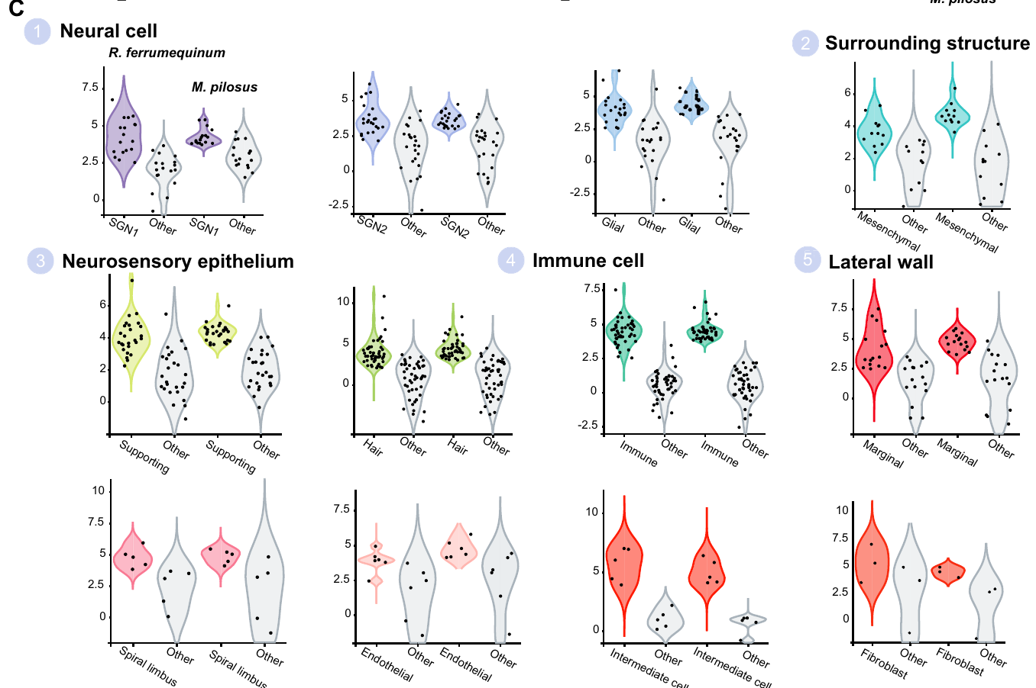
Neural expression categories differ between CF and FM bats
Wang and colleagues compared corresponding cochlear cell types using their joint 26-cluster atlas. Spiral-ganglion populations shared neuronal expression features, while species-associated differences appeared within those broader identities. The distinction concerns the molecular organization of peripheral auditory cells rather than the existence of an entirely separate sensory organ.
Gene-expression distributions describe how RNA abundance varies across a cellular population. The published comparisons preserved cell-type identity while evaluating expression across the CF and FM species. This makes it possible to ask whether a neural category is conserved and whether its molecular profile differs between echolocation strategies.
Molecular heterogeneity describes how RNA abundance varies across a cellular population. A relatively uniform RNA population could contain physiologically diverse neurons, and the molecular comparison motivates targeted electrophysiological tests of tuning in the corresponding neurons.
Wang et al. (2025), Fig. 4(C). Cross-species expression distributions in identified cell types.
Wang et al. (2025)
22
Notes:
• Wang and colleagues compared corresponding cochlear cell types using their joint 26-cluster atlas. Spiral-ganglion populations shared neuronal expression features, while species-associated differences appeared within those broader identities. The distinction concerns the molecular organization of peripheral auditory cells rather than the existence of an entirely separate sensory organ.
• Gene-expression distributions describe how RNA abundance varies across a cellular population. The published comparisons preserved cell-type identity while evaluating expression across the CF and FM species. This makes it possible to ask whether a neural category is conserved and whether its molecular profile differs between echolocation strategies.
• Molecular heterogeneity describes how RNA abundance varies across a cellular population. A relatively uniform RNA population could contain physiologically diverse neurons, and the molecular comparison motivates targeted electrophysiological tests of tuning in the corresponding neurons.
References:
Wang X, Bao M, Wang H, Sun R, Dai W, Sun K, Zhu Y, Pu Y, Chu Y, Li X, Wang T, Zhang M, Lin A, Li J, Feng J (2025). Cochlear Cell Atlas of Two Laryngeal Echolocating Bats—New Evidence for the Adaptive Nervous Physiology in Constant Frequency Bat. Molecular Ecology Resources 25:e14101. https://doi.org/10.1111/1755-0998.14101
Figure: Wang et al. (2025), Fig. 4(C). Cross-species expression distributions in identified cell types.
Figure source: https://doi.org/10.1111/1755-0998.14101

Slide 31
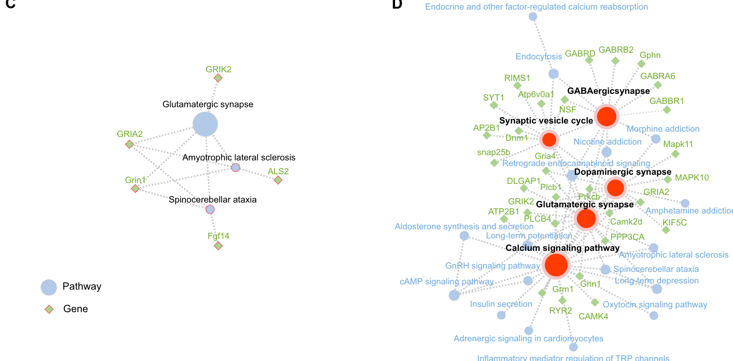
GABA receptor pathways suggest testable inhibitory roles
GABA is an inhibitory transmitter in many neural systems. Wang and colleagues identified GABAergic-synapse pathway enrichment in a horseshoe-bat SGN1 category, alongside glutamatergic, dopaminergic pathways associated with the transmitter dopamine, and calcium-signaling pathways. Their analysis associated 233 highly expressed genes with this species-specific neuronal category.
The pathway included GABA A and GABA B receptor annotations. These name distinct receptor classes through which GABA can influence cellular signaling. The atlas measured RNA, not receptor binding, synaptic inhibition or a response to a pharmacological blocker. Its two receptor annotations therefore identify candidates rather than a demonstrated inhibitory circuit.
The authors proposed a connection to specialized CF processing and vocal compensation. The pathway includes GABA A and GABA B receptor annotations, distinct receptor classes through which GABA can influence cellular signaling, so the atlas identifies candidate inhibitory roles that receptor-specific interventions and neuronal measurements can test.
Wang et al. (2025), Fig. 5(C–D). Original neuronal expression and pathway-enrichment panels.
Wang et al. (2025)
23
Notes:
• GABA is an inhibitory transmitter in many neural systems. Wang and colleagues identified GABAergic-synapse pathway enrichment in a horseshoe-bat SGN1 category, alongside glutamatergic, dopaminergic pathways associated with the transmitter dopamine, and calcium-signaling pathways. Their analysis associated 233 highly expressed genes with this species-specific neuronal category.
• The pathway included GABA A and GABA B receptor annotations. These name distinct receptor classes through which GABA can influence cellular signaling. The atlas measured RNA, not receptor binding, synaptic inhibition or a response to a pharmacological blocker. Its two receptor annotations therefore identify candidates rather than a demonstrated inhibitory circuit.
• The authors proposed a connection to specialized CF processing and vocal compensation. The pathway includes GABA A and GABA B receptor annotations, distinct receptor classes through which GABA can influence cellular signaling, so the atlas identifies candidate inhibitory roles that receptor-specific interventions and neuronal measurements can test.
References:
Wang X, Bao M, Wang H, Sun R, Dai W, Sun K, Zhu Y, Pu Y, Chu Y, Li X, Wang T, Zhang M, Lin A, Li J, Feng J (2025). Cochlear Cell Atlas of Two Laryngeal Echolocating Bats—New Evidence for the Adaptive Nervous Physiology in Constant Frequency Bat. Molecular Ecology Resources 25:e14101. https://doi.org/10.1111/1755-0998.14101
Figure: Wang et al. (2025), Fig. 5(C–D). Original neuronal expression and pathway-enrichment panels.
Figure source: https://doi.org/10.1111/1755-0998.14101

Slide 32
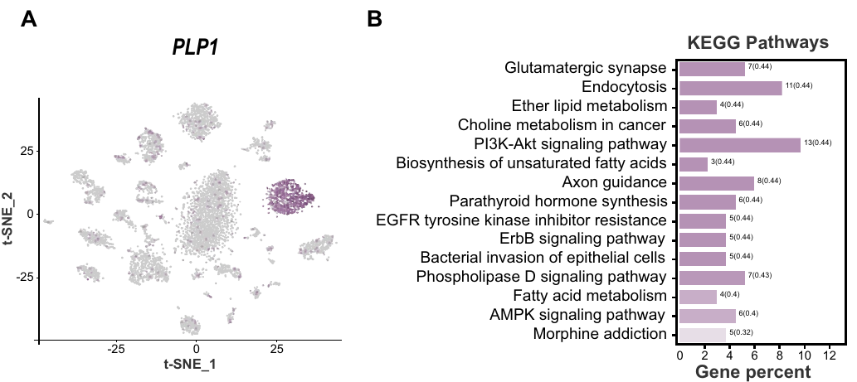
Glial signaling is inferred from expression relationships
Glial cells support and interact with neurons without being classified as the principal signal-carrying sensory neurons. Wang and colleagues localized PLP1 expression in their cochlear atlas and examined highly expressed genes within the glial category. The analysis associated this category with cell communication and several neural-support processes.
The horseshoe-bat atlas distinguishes glia from SGN1 and SGN2, allowing support-cell expression to be studied separately from neuronal expression. Ligand–receptor inference predicts possible communication when one cell class expresses a signaling molecule and another expresses a corresponding receptor. Such inference is based on molecular compatibility, not direct observation of transmission.
The study proposed interactions involving neural adhesion and growth-associated signaling. Ligand–receptor inference predicts possible communication when one cell class expresses a signaling molecule and another expresses a corresponding receptor, and glial molecular specialization is a candidate contributor to the sensory environment of the cochlea.
Wang et al. (2025), Fig. 6(A–B). Glial marker localization and functional gene categories.
Wang et al. (2025)
24
Notes:
• Glial cells support and interact with neurons without being classified as the principal signal-carrying sensory neurons. Wang and colleagues localized PLP1 expression in their cochlear atlas and examined highly expressed genes within the glial category. The analysis associated this category with cell communication and several neural-support processes.
• The horseshoe-bat atlas distinguishes glia from SGN1 and SGN2, allowing support-cell expression to be studied separately from neuronal expression. Ligand–receptor inference predicts possible communication when one cell class expresses a signaling molecule and another expresses a corresponding receptor. Such inference is based on molecular compatibility, not direct observation of transmission.
• The study proposed interactions involving neural adhesion and growth-associated signaling. Ligand–receptor inference predicts possible communication when one cell class expresses a signaling molecule and another expresses a corresponding receptor, and glial molecular specialization is a candidate contributor to the sensory environment of the cochlea.
References:
Wang X, Bao M, Wang H, Sun R, Dai W, Sun K, Zhu Y, Pu Y, Chu Y, Li X, Wang T, Zhang M, Lin A, Li J, Feng J (2025). Cochlear Cell Atlas of Two Laryngeal Echolocating Bats—New Evidence for the Adaptive Nervous Physiology in Constant Frequency Bat. Molecular Ecology Resources 25:e14101. https://doi.org/10.1111/1755-0998.14101
Figure: Wang et al. (2025), Fig. 6(A–B). Glial marker localization and functional gene categories.
Figure source: https://doi.org/10.1111/1755-0998.14101

Slide 33
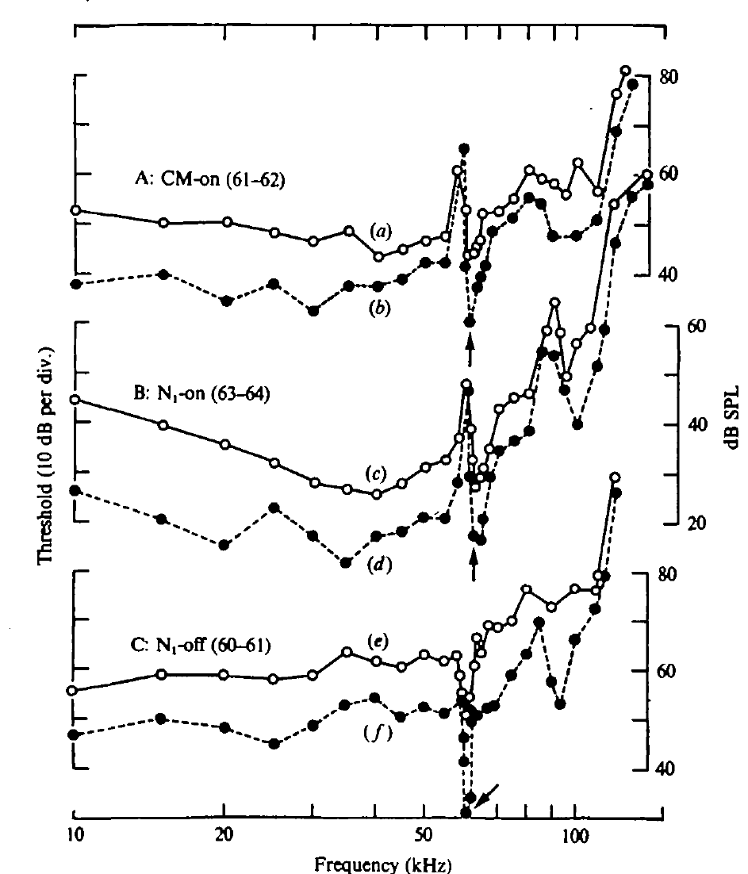
The cochlear response is sharply tuned near CF2
CF2 is the constant-frequency component of the second harmonic. In Suga and colleagues’ mustached bats, Pteronotus parnellii, CF2 lay near 61–62 kHz. The CM threshold curve contained a pronounced sensitivity notch in approximately this band.
The best frequencies depended on the recorded response: CM onset was most sensitive near 61–62 kHz, summed neural onset near 63–64 kHz, and summed neural offset near 60–61 kHz. Onset and offset refer to the beginning and cessation of the stimulus.
A sharply tuned receptor-related response indicates specialization before cortical processing. The recorded CM onset, neural onset and neural offset signals had different best frequencies, and the displaced neural onset minimum was related to the time course of cochlear excitation, so a population onset measure reflects response timing as well as sensitivity.
Wang et al. (2025), Fig. 1(D–E). Published cochlear anatomy and stained tissue sections.
Suga et al. (1975), Fig. 2(A–C). Threshold notches of CM onset, neural onset, and neural offset, in kHz.
Suga et al. (1975); Wang et al. (2025)
25
Notes:
• The second harmonic of the constant-frequency call is abbreviated CF2. Its frequency was about 61 to 62 kilohertz in the mustached bats studied. The receptor-related threshold curve had a narrow notch near that range.
• The minimum threshold of a response identifies the sound level required to evoke it. The recorded CM onset, neural onset, and neural offset signals did not have identical best frequencies. An onset response measures a different event from discharge at the cessation of the same sound.
• The narrow CM sensitivity supports a peripheral specialization. Suga and colleagues related the displaced neural onset minimum to the time course of cochlear excitation. A population onset measure is therefore not a complete substitute for sustained hearing sensitivity or for the tuning of individual neurons.
References:
Suga N, Simmons JA, Jen PH-S (1975). Peripheral specialization for fine analysis of Doppler-shifted echoes in the auditory system of the “CF-FM” bat Pteronotus parnellii. Journal of Experimental Biology 63(1):161–192. https://doi.org/10.1242/jeb.63.1.161
Wang X, Bao M, Wang H, Sun R, Dai W, Sun K, Zhu Y, Pu Y, Chu Y, Li X, Wang T, Zhang M, Lin A, Li J, Feng J (2025). Cochlear Cell Atlas of Two Laryngeal Echolocating Bats—New Evidence for the Adaptive Nervous Physiology in Constant Frequency Bat. Molecular Ecology Resources 25:e14101. https://doi.org/10.1111/1755-0998.14101
Figure: Suga et al. (1975), Fig. 2(A–C). Threshold notches of CM onset, neural onset, and neural offset, in kHz.
Figure source: https://doi.org/10.1242/jeb.63.1.161
Figure: Wang et al. (2025), Fig. 1(D–E). Published cochlear anatomy and stained tissue sections.
Figure source: https://doi.org/10.1111/1755-0998.14101

Slide 34
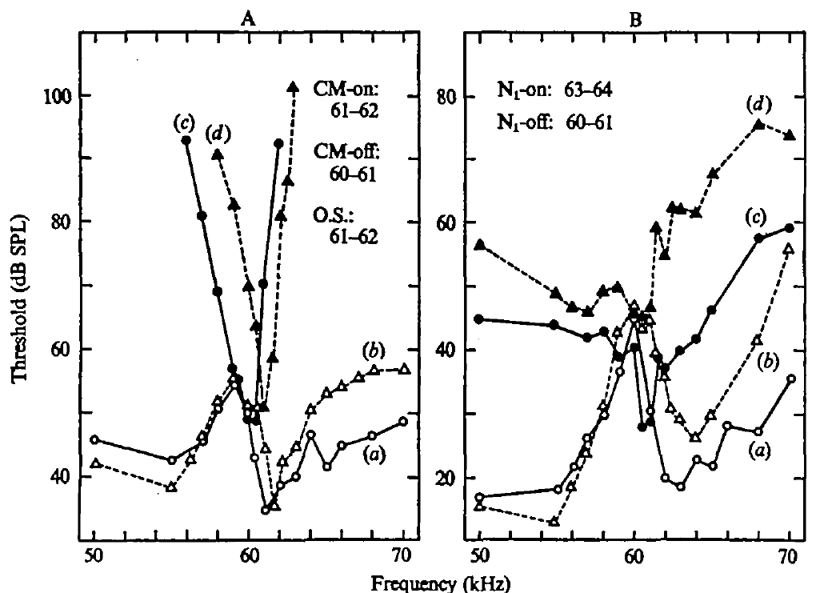
A cochlear resonator prolongs excitation after sound ends
A resonator responds especially strongly near a particular frequency and can continue oscillating after stimulation stops. Near the CF2 band, Suga and colleagues found that CM activity built up and decayed slowly compared with responses farther from the tuned range.
The residual CM activity after stimulus cessation was called CM-after. Its transient behavior was consistent with mechanical ringing in the inner ear. A neural offset response accompanied these peripheral events rather than requiring a new acoustic pulse.
Resonance links high frequency selectivity to a distinctive time course. The ear does not reproduce the imposed tone-burst envelope identically at every frequency. A sound with a sharp external ending can therefore produce continuing or changing receptor excitation inside the cochlea.
Wang et al. (2025), Fig. 1(D–E). Published cochlear anatomy and stained tissue sections.
Suga et al. (1975), Fig. 3(A–B). Different best frequencies of cochlear and neural onset and offset responses.
Suga et al. (1975); Wang et al. (2025)
26
Notes:
• Mechanical resonance combines frequency preference with persistence in time. A system that is strongly energized near its resonant frequency can continue moving after the external driving sound stops.
• The recorded cochlear microphonic had a slow build-up and residual activity near the tuned CF band. Suga and colleagues called the residual activity CM-after. The measurements connected the neural activity at stimulus offset to events already present in the cochlear signal.
• The external acoustic envelope specifies when sound is delivered, whereas the cochlear envelope specifies how the peripheral response develops. Those envelopes differed near resonance. A neural response after the stimulus cannot consequently be assumed to originate from a central rebound mechanism solely because the loudspeaker has become silent.
References:
Suga N, Simmons JA, Jen PH-S (1975). Peripheral specialization for fine analysis of Doppler-shifted echoes in the auditory system of the “CF-FM” bat Pteronotus parnellii. Journal of Experimental Biology 63(1):161–192. https://doi.org/10.1242/jeb.63.1.161
Wang X, Bao M, Wang H, Sun R, Dai W, Sun K, Zhu Y, Pu Y, Chu Y, Li X, Wang T, Zhang M, Lin A, Li J, Feng J (2025). Cochlear Cell Atlas of Two Laryngeal Echolocating Bats—New Evidence for the Adaptive Nervous Physiology in Constant Frequency Bat. Molecular Ecology Resources 25:e14101. https://doi.org/10.1111/1755-0998.14101
Figure: Suga et al. (1975), Fig. 3(A–B). Different best frequencies of cochlear and neural onset and offset responses.
Figure source: https://doi.org/10.1242/jeb.63.1.161
Figure: Wang et al. (2025), Fig. 1(D–E). Published cochlear anatomy and stained tissue sections.
Figure source: https://doi.org/10.1111/1755-0998.14101

Slide 35
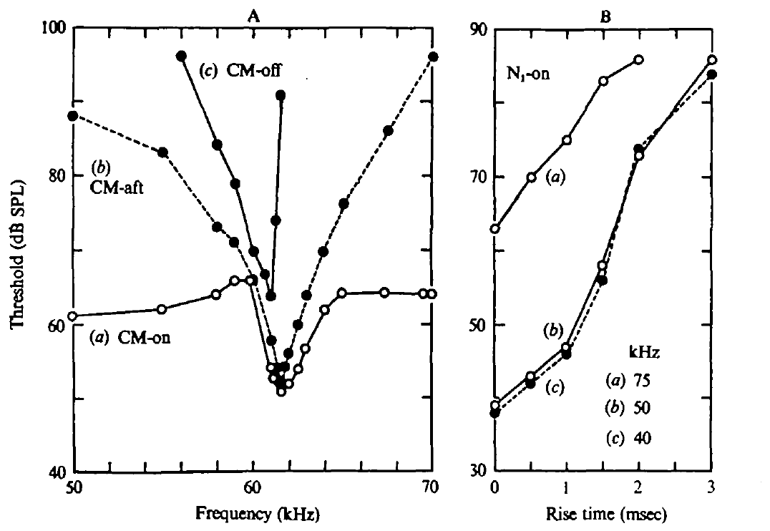
Onset synchrony depends on the sound envelope
The envelope is the changing amplitude of a sound or response over time. Slow cochlear build-up near resonance can spread the onset times of individual neural impulses. A summed neural onset response becomes smaller when those impulses are less synchronized.
Suga and colleagues varied the rise time of tones away from the resonant band. Lengthening rise time raised the threshold of the summed onset response. A 1 ms rise produced an approximately 8 dB threshold increase relative to an abrupt rise; a 3 ms rise produced a much larger increase.
This control supports an envelope-based explanation of the apparent onset-threshold shift. A weak summed response can result from dispersed spike timing even when individual neurons remain sensitive. Population synchrony and acoustic sensitivity must be distinguished.
Wang et al. (2025), Fig. 1(D–E). Published cochlear anatomy and stained tissue sections.
Suga et al. (1975), Fig. 4(A–B). Cochlear transients and the dependence of neural onset threshold on rise time.
Suga et al. (1975); Wang et al. (2025)
27
Notes:
• The amplitude envelope determines how quickly a sound reaches its sustained level. Individual neurons need not fire their first impulses at precisely the same time when excitation rises slowly.
• A summed onset potential depends on those impulses overlapping in time. If they are spread out, the recorded population peak can be smaller without requiring every neuron to become less responsive. The experiment lengthened the stimulus rise time at frequencies away from resonance to test this timing effect independently.
• The onset threshold rose when the sound rose more slowly. That result supports the interpretation that resonance can alter the apparent neural onset sensitivity by changing synchronization. It does not require the entire auditory system to prefer the frequency at which the largest summed onset response happens to be measured.
References:
Suga N, Simmons JA, Jen PH-S (1975). Peripheral specialization for fine analysis of Doppler-shifted echoes in the auditory system of the “CF-FM” bat Pteronotus parnellii. Journal of Experimental Biology 63(1):161–192. https://doi.org/10.1242/jeb.63.1.161
Wang X, Bao M, Wang H, Sun R, Dai W, Sun K, Zhu Y, Pu Y, Chu Y, Li X, Wang T, Zhang M, Lin A, Li J, Feng J (2025). Cochlear Cell Atlas of Two Laryngeal Echolocating Bats—New Evidence for the Adaptive Nervous Physiology in Constant Frequency Bat. Molecular Ecology Resources 25:e14101. https://doi.org/10.1111/1755-0998.14101
Figure: Suga et al. (1975), Fig. 4(A–B). Cochlear transients and the dependence of neural onset threshold on rise time.
Figure source: https://doi.org/10.1242/jeb.63.1.161
Figure: Wang et al. (2025), Fig. 1(D–E). Published cochlear anatomy and stained tissue sections.
Figure source: https://doi.org/10.1111/1755-0998.14101

Slide 36
Synchrony shapes the population onset response
The envelope is the changing amplitude of a sound or response over time, and it determines how quickly a sound reaches its sustained level. When excitation rises slowly, individual neurons do not fire their first impulses at the same moment.
A summed onset response depends on impulses overlapping in time. If they are spread out, the recorded population peak is smaller even though every neuron remains sensitive, so a weak summed response can reflect dispersed spike timing and not reduced sensitivity.
Suga and colleagues lengthened the rise time of tones away from the resonant band. A 1-ms rise raised the threshold of the summed onset response by approximately 8 dB relative to an abrupt rise, and a 3-ms rise raised it much more, which supports an envelope-based explanation of the apparent threshold shift.
Wang et al. (2025), Fig. 1(D–E). Published cochlear anatomy and stained tissue sections.
Suga et al. (1975), Fig. 4(A–B). Cochlear transients and the dependence of neural onset threshold on rise time.
Suga et al. (1975); Wang et al. (2025)
27a
Notes:
• Population responses depend on both how many neurons respond and how well their impulses line up in time.
• Envelope and onset.
– The amplitude envelope determines how quickly a sound reaches its sustained level.
– Slow rises spread the times of the first impulses across neurons.
• Why synchrony matters.
– A summed onset potential depends on impulses overlapping in time.
– If the impulses are spread out, the recorded peak is smaller without every neuron becoming less responsive.
• The test.
– Suga and colleagues lengthened the stimulus rise time at frequencies away from resonance.
– The onset threshold rose when the sound rose more slowly.
• Consequence.
– Resonance can alter apparent neural onset sensitivity by changing synchronization.
– The frequency at which the largest summed onset response happens to be measured is therefore not the preferred frequency of the whole auditory system.
• Rise time and timing.
– A slow envelope delays and disperses the first impulses of different neurons.
– The summed onset response then has a smaller peak although each neuron stays sensitive.
• Size of the effect.
– A 1-millisecond rise raised the onset threshold by approximately 8 decibels relative to an abrupt rise, and a 3-millisecond rise raised it much more.
References:
Suga N, Simmons JA, Jen PH-S (1975). Peripheral specialization for fine analysis of Doppler-shifted echoes in the auditory system of the “CF-FM” bat Pteronotus parnellii. Journal of Experimental Biology 63(1):161–192. https://doi.org/10.1242/jeb.63.1.161
Wang X, Bao M, Wang H, Sun R, Dai W, Sun K, Zhu Y, Pu Y, Chu Y, Li X, Wang T, Zhang M, Lin A, Li J, Feng J (2025). Cochlear Cell Atlas of Two Laryngeal Echolocating Bats—New Evidence for the Adaptive Nervous Physiology in Constant Frequency Bat. Molecular Ecology Resources 25:e14101. https://doi.org/10.1111/1755-0998.14101

Slide 37
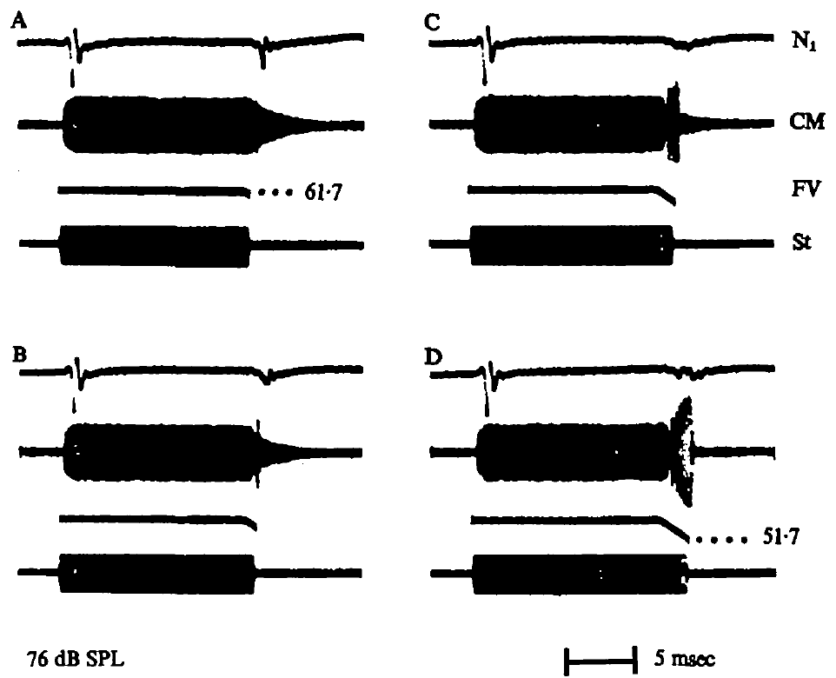
Terminal FM suppresses cochlear offset transients
Suga and colleagues compared a CF tone ending abruptly with the same tone followed by a downward FM component. The added sweep changed the cochlear response after the sustained tone rather than merely adding a second independent response.
A terminal FM sweep reduced residual CM activity and the summed neural offset response under the tested conditions. The effect depended on the sweep’s extent and duration. CF and FM therefore interact in the peripheral time course of excitation.
The finding connects the acoustic structure of a natural CF-FM signal to cochlear mechanics. Changing the duration and extent of the terminal sweep changed the outcome, so the CF and FM components are not independent sounds whose responses add, and a brief FM ending alters how the resonant system stops responding to CF stimulation.
Suga et al. (1975), Fig. 8(A–D). Terminal FM changes cochlear ringing and the summed neural offset response.
Suga et al. (1975)
28
Notes:
• A pure CF tone with an abrupt ending can leave a resonating cochlear response. The experiment added a downward frequency sweep to the end of that tone, creating a CF-FM stimulus more similar to a bat’s call.
• The cochlear residual response and the summed neural offset response were reduced. Changing the duration and extent of the terminal sweep changed the outcome, so the components cannot be treated as independent sounds whose responses simply add together.
• This interaction was measured in controlled peripheral recordings. It establishes that a brief FM ending can alter how the resonant system stops responding to CF stimulation. It does not directly measure prey capture or prove that the same degree of suppression occurs for every natural call and echo.
References:
Suga N, Simmons JA, Jen PH-S (1975). Peripheral specialization for fine analysis of Doppler-shifted echoes in the auditory system of the “CF-FM” bat Pteronotus parnellii. Journal of Experimental Biology 63(1):161–192. https://doi.org/10.1242/jeb.63.1.161
Figure: Suga et al. (1975), Fig. 8(A–D). Terminal FM changes cochlear ringing and the summed neural offset response.
Figure source: https://doi.org/10.1242/jeb.63.1.161

Slide 38
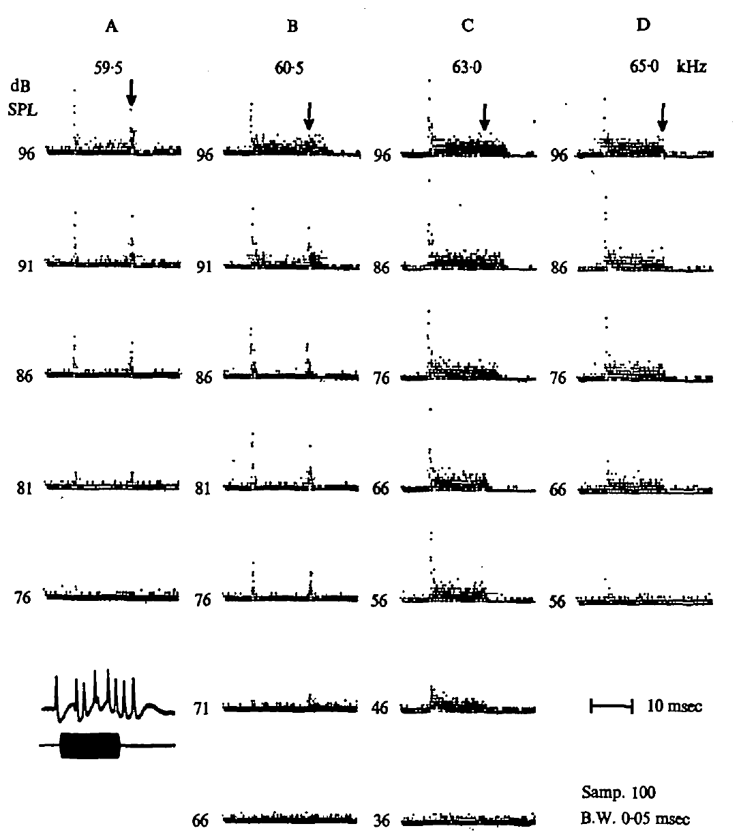
Peripheral neurons can discharge when a tone ends
Suga and colleagues recorded individual peripheral auditory neurons, sampling the auditory nerve and nearby cochlear nucleus. A post-stimulus-time histogram aligns impulses from repeated trials to the onset of the same stimulus.
Individual neurons could produce sustained activity during a tone and concentrated discharges after its cessation. For some tested frequencies and levels, the offset discharge remained prominent even when sustained activity was weak.
These offset responses linked the summed N1-offset signal to individual neural activity. They occurred in neurons with excitatory tone responses, rather than requiring a separate population responding only at offset. The offset cluster could remain conspicuous at low levels or particular frequencies while the sustained response was much weaker, so the observation provides a cellular counterpart to the summed neural offset potential.
Suga et al. (1975), Fig. 9(A–D). Single-neuron responses across tone frequency and level, with offset discharges.
Suga et al. (1975)
29
Notes:
• An individual neuron’s impulse times can be compared across repeated presentations of a tone. Aligning those times to stimulus onset produces a post-stimulus-time histogram, which distinguishes onset, sustained, and later activity.
• The sampled neurons included auditory-nerve and nearby cochlear-nucleus recordings. Some neurons produced a distinct cluster of impulses after the tone ended. At lower levels or particular frequencies, this offset cluster could remain conspicuous while the sustained response was much weaker.
• The observation supplies a cellular counterpart to the summed neural offset potential. These were not necessarily neurons with an exclusive offset-only function. The data relate individual activity to peripheral transients and cannot be used to assign the same response to a specific cortical cell type.
References:
Suga N, Simmons JA, Jen PH-S (1975). Peripheral specialization for fine analysis of Doppler-shifted echoes in the auditory system of the “CF-FM” bat Pteronotus parnellii. Journal of Experimental Biology 63(1):161–192. https://doi.org/10.1242/jeb.63.1.161
Figure: Suga et al. (1975), Fig. 9(A–D). Single-neuron responses across tone frequency and level, with offset discharges.
Figure source: https://doi.org/10.1242/jeb.63.1.161

Slide 39
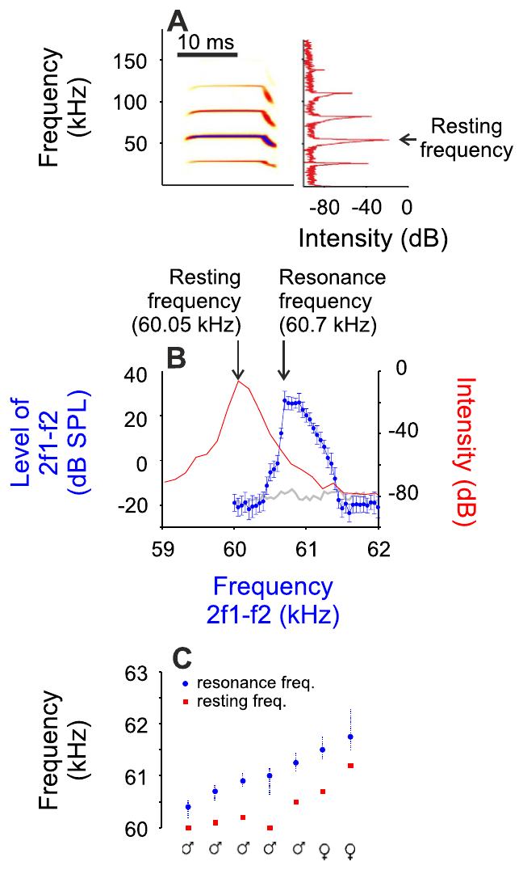
Resonance frequency differs from the resting call baseline
Resonance frequency is the frequency at which the peripheral resonant system responds especially strongly. Macías and colleagues distinguished it from the resting second-harmonic call frequency in mustached bats. Resting emissions ranged from 60 to 61.2 kHz in their animals, while the resonance estimate generally lay above the emitted baseline.
They combined acoustic recordings with auditory-midbrain recordings and examined sharply tuned neurons near the specialized band. A reference defined from vocal emission therefore need not coincide exactly with a reference defined from the sensory response. This distinction parallels the resting-versus-reference frequency difference in behavioral compensation experiments.
The measurement distinguishes two biologically related frequency values rather than assigning one universal CF frequency to the species. Neural tuning was evaluated relative to the individual bat’s acoustic and peripheral specialization. A reference defined from vocal emission need not coincide with a reference defined from the sensory response, which parallels the difference between resting and reference frequencies in behavioral compensation experiments.
Macías et al. (2016), Fig. 1(A–C). Resting emissions and cochlear resonance estimates.
Macías et al. (2016)
30
Notes:
• Resonance frequency is the frequency at which the peripheral resonant system responds especially strongly. Macías and colleagues distinguished it from the resting second-harmonic call frequency in mustached bats. Resting emissions ranged from 60 to 61.2 kHz in their animals, while the resonance estimate generally lay above the emitted baseline.
• They combined acoustic recordings with auditory-midbrain recordings and examined sharply tuned neurons near the specialized band. A reference defined from vocal emission therefore need not coincide exactly with a reference defined from the sensory response. This distinction parallels the resting-versus-reference frequency difference in behavioral compensation experiments.
• The measurement distinguishes two biologically related frequency values rather than assigning one universal CF frequency to the species. Neural tuning was evaluated relative to the individual bat’s acoustic and peripheral specialization. A reference defined from vocal emission need not coincide with a reference defined from the sensory response, which parallels the difference between resting and reference frequencies in behavioral compensation experiments.
References:
Macías S, Hechavarría JC, Kössl M (2016). Sharp temporal tuning in the bat auditory midbrain overcomes spectral-temporal trade-off imposed by cochlear mechanics. Scientific Reports 6:29129. https://doi.org/10.1038/srep29129
Figure: Macías et al. (2016), Fig. 1(A–C). Resting emissions and cochlear resonance estimates.
Figure source: https://doi.org/10.1038/srep29129

Slide 40
Resonance frequency differs from resting frequency
The resonance frequency is the frequency at which the peripheral resonant system of the ear responds especially strongly. It describes the sensory side of the system, whereas the resting frequency describes the vocal side.
Macías and colleagues measured the resting second-harmonic call frequency in mustached bats, which ranged from 60 to 61.2 kHz, and estimated the resonance frequency, which generally lay above the emitted baseline. They combined acoustic recordings with recordings in the auditory midbrain and examined sharply tuned neurons near the specialized band.
A reference defined from vocal emission therefore need not coincide with a reference defined from the sensory response. The distinction parallels the difference between resting and reference frequencies in the behavioral compensation experiments, and neural tuning was evaluated relative to each individual bat's acoustic and peripheral specialization.
Macías et al. (2016), Fig. 1(A–C). Resting emissions and cochlear resonance estimates.
Macías et al. (2016)
30a
Notes:
• A bat has a sensory frequency reference and a vocal frequency reference, and the two are related but not identical.
• Sensory reference.
– The resonance frequency is where the peripheral resonant system responds most strongly.
– The estimate generally lay above the resting emission.
• Vocal reference.
– The resting second-harmonic frequency ranged from 60 to 61.2 kHz in these mustached bats.
– It is measured from the calls of a stationary animal.
• Parallel with compensation.
– In compensation experiments the reference frequency of the echo lies slightly above the resting frequency of the call.
– The sensory and vocal measures show a similar relationship.
• Individual tuning.
– Neural tuning was evaluated relative to the acoustic and peripheral specialization of each bat, which avoids assigning one universal CF frequency to the species.
• Sensory and vocal references.
– The resonance frequency describes the sensory side of the system, and the resting frequency describes the vocal side.
– The two need not coincide.
• Measurements.
– The resting second-harmonic frequency ranged from 60 to 61.2 kilohertz, and the estimated resonance frequency generally lay above it.
– Neural recordings in the auditory midbrain examined sharply tuned neurons near the specialized band.
References:
Macías S, Hechavarría JC, Kössl M (2016). Sharp temporal tuning in the bat auditory midbrain overcomes spectral-temporal trade-off imposed by cochlear mechanics. Scientific Reports 6:29129. https://doi.org/10.1038/srep29129

Slide 41
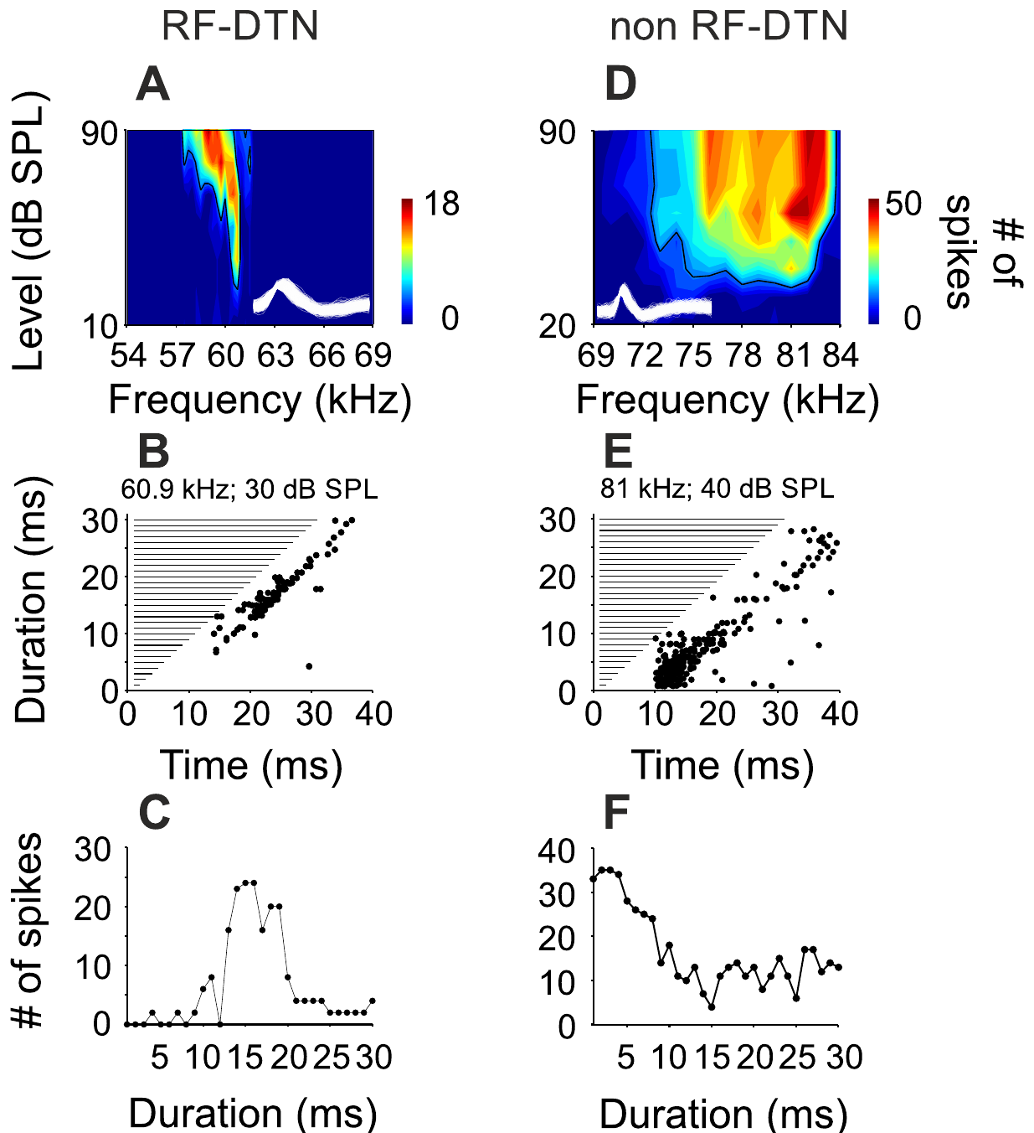
Midbrain neurons can prefer a narrow sound duration
A duration-tuned neuron responds most strongly to a restricted range of sound durations. Macías and colleagues recorded single-neuron activity in the mustached bat’s inferior colliculus, an auditory midbrain structure. Pure-tone stimuli varied in frequency, sound level and duration, separating several dimensions of response selectivity.
One resonance-band neuron preferred 60.9 kHz, with a frequency bandwidth of 0.75 kHz. It preferred a 15-ms stimulus, with a duration bandwidth of 7 ms. A comparison neuron tuned to 81 kHz had a broader 9-kHz frequency bandwidth and preferred a 3-ms stimulus.
These examples establish joint spectral and temporal selectivity in central auditory neurons. Sharp duration tuning coexists with sharply tuned peripheral input, so the long cochlear ringing does not force every central response to be temporally broad.
Macías et al. (2016), Fig. 2(A–F). Frequency response areas and measured duration tuning.
Macías et al. (2016)
31
Notes:
• A duration-tuned neuron responds most strongly to a restricted range of sound durations. Macías and colleagues recorded single-neuron activity in the mustached bat’s inferior colliculus, an auditory midbrain structure. Pure-tone stimuli varied in frequency, sound level and duration, separating several dimensions of response selectivity.
• One resonance-band neuron preferred 60.9 kHz, with a frequency bandwidth of 0.75 kHz. It preferred a 15-ms stimulus, with a duration bandwidth of 7 ms. A comparison neuron tuned to 81 kHz had a broader 9-kHz frequency bandwidth and preferred a 3-ms stimulus.
• These examples establish joint spectral and temporal selectivity in central auditory neurons. Sharp duration tuning coexists with sharply tuned peripheral input, so the long cochlear ringing does not force every central response to be temporally broad.
References:
Macías S, Hechavarría JC, Kössl M (2016). Sharp temporal tuning in the bat auditory midbrain overcomes spectral-temporal trade-off imposed by cochlear mechanics. Scientific Reports 6:29129. https://doi.org/10.1038/srep29129
Figure: Macías et al. (2016), Fig. 2(A–F). Frequency response areas and measured duration tuning.
Figure source: https://doi.org/10.1038/srep29129

Slide 42
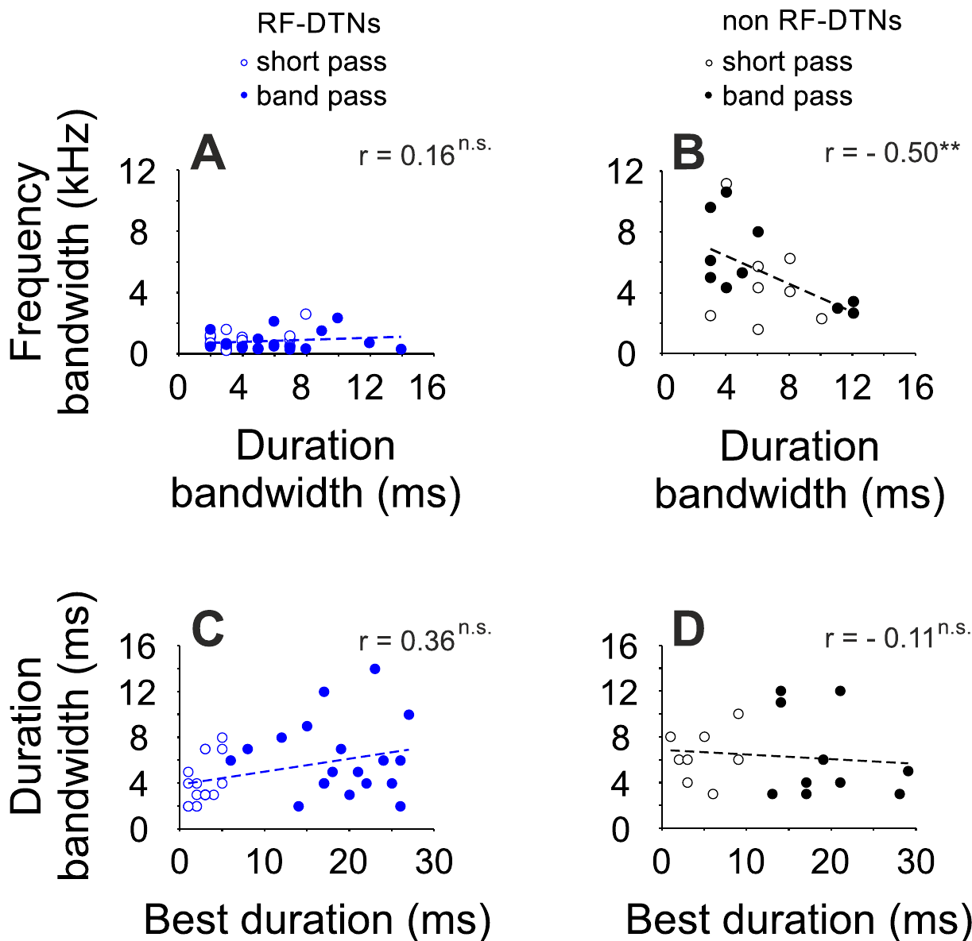
Sharp spectral tuning need not sacrifice duration tuning
A spectral–temporal trade-off occurs when finer frequency resolution accompanies poorer temporal resolution. Cochlear resonance can sustain activity after sound offset, extending the peripheral response. Macías and colleagues asked whether this peripheral property constrains duration-selective neurons in the auditory midbrain.
They measured frequency bandwidth at 10 dB above threshold and duration bandwidth across stimulus durations. Resonance-band neurons did not follow the expected relation between narrow frequency tuning and broad duration tuning. Neurons outside that specialized band displayed the more conventional relationship between the two response dimensions.
The result concerns central response selectivity under controlled pure-tone stimulation. Central processing can produce sharp temporal filtering despite a peripheral input specialized for narrowband frequency analysis, and neurons outside the specialized band displayed the more conventional relationship between frequency and duration tuning.
Macías et al. (2016), Fig. 4(A–D). Relations between frequency and duration bandwidths.
Macías et al. (2016)
32
Notes:
• A spectral–temporal trade-off occurs when finer frequency resolution accompanies poorer temporal resolution. Cochlear resonance can sustain activity after sound offset, extending the peripheral response. Macías and colleagues asked whether this peripheral property constrains duration-selective neurons in the auditory midbrain.
• They measured frequency bandwidth at 10 dB above threshold and duration bandwidth across stimulus durations. Resonance-band neurons did not follow the expected relation between narrow frequency tuning and broad duration tuning. Neurons outside that specialized band displayed the more conventional relationship between the two response dimensions.
• The result concerns central response selectivity under controlled pure-tone stimulation. Central processing can produce sharp temporal filtering despite a peripheral input specialized for narrowband frequency analysis, and neurons outside the specialized band displayed the more conventional relationship between frequency and duration tuning.
References:
Macías S, Hechavarría JC, Kössl M (2016). Sharp temporal tuning in the bat auditory midbrain overcomes spectral-temporal trade-off imposed by cochlear mechanics. Scientific Reports 6:29129. https://doi.org/10.1038/srep29129
Figure: Macías et al. (2016), Fig. 4(A–D). Relations between frequency and duration bandwidths.
Figure source: https://doi.org/10.1038/srep29129

Slide 43
Frequency resolution and time resolution trade off
A spectral–temporal trade-off occurs when finer frequency resolution accompanies poorer temporal resolution. A sharply tuned resonator is an example: it selects a narrow band of frequencies and continues to respond after the sound ends, which extends the peripheral response in time.
Macías and colleagues asked whether this cochlear property constrains duration-selective neurons in the auditory midbrain. They measured frequency bandwidth at 10 dB above threshold and duration bandwidth across stimulus durations in the mustached bat's inferior colliculus.
Resonance-band neurons did not follow the expected relation between narrow frequency tuning and broad duration tuning, whereas neurons outside the specialized band showed the conventional relationship. Central processing can therefore produce sharp temporal filtering despite a peripheral input that is specialized for narrowband frequency analysis.
Macías et al. (2016), Fig. 4(A–D). Relations between frequency and duration bandwidths.
Macías et al. (2016)
32a
Notes:
• A trade-off between frequency and time resolution is expected for a tuned system, and the midbrain data test whether it carries through to central neurons.
• The trade-off.
– Finer frequency resolution accompanies poorer temporal resolution.
– Cochlear resonance can sustain activity after sound offset.
• The measurements.
– Frequency bandwidth was measured at 10 dB above threshold.
– Duration bandwidth was measured across stimulus durations.
• The result.
– Resonance-band neurons did not follow the expected relation between narrow frequency tuning and broad duration tuning.
– Neurons outside that specialized band displayed the more conventional relationship.
• Interpretation.
– The result concerns central response selectivity under controlled pure-tone stimulation, and central processing can sharpen temporal filtering that the periphery does not provide.
• Meaning of the trade-off.
– A narrowly tuned resonator selects few frequencies and keeps responding after the sound ends.
– Fine frequency resolution therefore costs temporal resolution.
• The midbrain test.
– Frequency bandwidth was measured at 10 decibels above threshold, and duration bandwidth was measured across stimulus durations.
– Neurons outside the specialized band followed the conventional relation, and resonance-band neurons did not.
References:
Macías S, Hechavarría JC, Kössl M (2016). Sharp temporal tuning in the bat auditory midbrain overcomes spectral-temporal trade-off imposed by cochlear mechanics. Scientific Reports 6:29129. https://doi.org/10.1038/srep29129

Slide 44
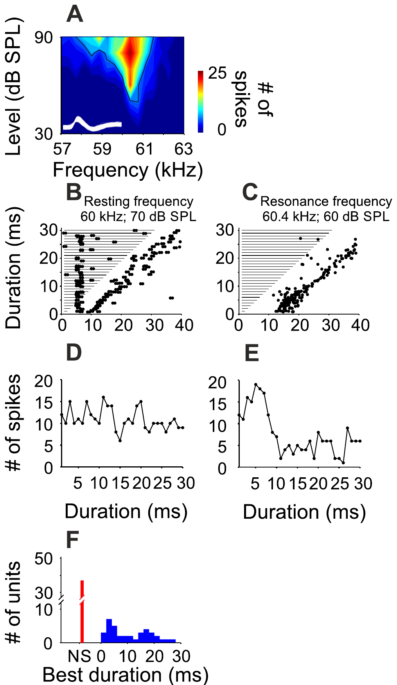
A small frequency change can reorganize duration tuning
Macías and colleagues tested the same resonance-band neurons with tones at the individual resting-call frequency and at the resonance frequency. This within-neuron comparison controlled cell identity while changing the acoustic frequency. The resting frequency lay just below the specialized resonant band.
Duration selectivity was clear at resonance but often absent at the resting frequency. Preferred durations at resonance clustered near 4 ms and 17 ms. The response to resting-frequency stimulation could instead remain broad across durations, despite the small spectral separation between the two stimulus conditions.
Frequency-dependent temporal filtering means that a neuron’s response to duration depends on the carrier frequency. A single duration preference therefore depends on the carrier frequency at which it is measured, and the experiment supports an interaction between spectral input and central temporal processing.
Macías et al. (2016), Fig. 5(A–F). Responses at resting and resonance frequencies.
Macías et al. (2016)
33
Notes:
• Macías and colleagues tested the same resonance-band neurons with tones at the individual resting-call frequency and at the resonance frequency. This within-neuron comparison controlled cell identity while changing the acoustic frequency. The resting frequency lay just below the specialized resonant band.
• Duration selectivity was clear at resonance but often absent at the resting frequency. Preferred durations at resonance clustered near 4 ms and 17 ms. The response to resting-frequency stimulation could instead remain broad across durations, despite the small spectral separation between the two stimulus conditions.
• Frequency-dependent temporal filtering means that a neuron’s response to duration depends on the carrier frequency. A single duration preference therefore depends on the carrier frequency at which it is measured, and the experiment supports an interaction between spectral input and central temporal processing.
References:
Macías S, Hechavarría JC, Kössl M (2016). Sharp temporal tuning in the bat auditory midbrain overcomes spectral-temporal trade-off imposed by cochlear mechanics. Scientific Reports 6:29129. https://doi.org/10.1038/srep29129
Figure: Macías et al. (2016), Fig. 5(A–F). Responses at resting and resonance frequencies.
Figure source: https://doi.org/10.1038/srep29129

Slide 45
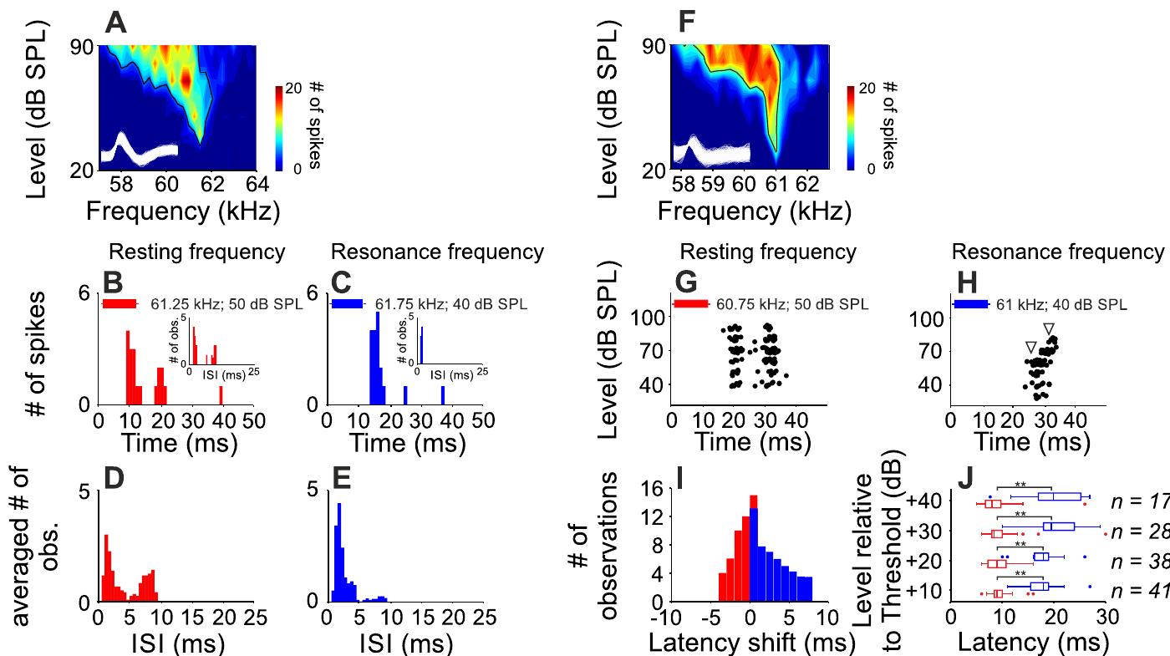
Resonance-band inhibition is still a hypothesis
Inhibition reduces neuronal output through synaptic or membrane mechanisms. Macías and colleagues proposed frequency-specific inhibition to explain why resonance-band neurons could be selective for duration despite cochlear ringing. Their recordings measured output spikes under different stimulus frequencies and sound levels.
The published response patterns and latency changes differed between resting and resonance stimulation. Duration tuning could be present at resonance but absent just below it. The authors considered temporally offset excitation and inhibition, including coincidence and anti-coincidence accounts, as explanations for this frequency-dependent selectivity.
The authors considered temporally offset excitation and inhibition, including coincidence and anti-coincidence accounts, as a central filtering hypothesis for the frequency-dependent duration selectivity. Behavioral compensation and central duration tuning are separate measured phenomena, even though both depend on the specialized CF band.
Macías et al. (2016), Fig. 6(A–J). Frequency-dependent response timing and latency shifts.
Macías et al. (2016)
34
Notes:
• Inhibition reduces neuronal output through synaptic or membrane mechanisms. Macías and colleagues proposed frequency-specific inhibition to explain why resonance-band neurons could be selective for duration despite cochlear ringing. Their recordings measured output spikes under different stimulus frequencies and sound levels.
• The published response patterns and latency changes differed between resting and resonance stimulation. Duration tuning could be present at resonance but absent just below it. The authors considered temporally offset excitation and inhibition, including coincidence and anti-coincidence accounts, as explanations for this frequency-dependent selectivity.
• The authors considered temporally offset excitation and inhibition, including coincidence and anti-coincidence accounts, as a central filtering hypothesis for the frequency-dependent duration selectivity. Behavioral compensation and central duration tuning are separate measured phenomena, even though both depend on the specialized CF band.
References:
Macías S, Hechavarría JC, Kössl M (2016). Sharp temporal tuning in the bat auditory midbrain overcomes spectral-temporal trade-off imposed by cochlear mechanics. Scientific Reports 6:29129. https://doi.org/10.1038/srep29129
Figure: Macías et al. (2016), Fig. 6(A–J). Frequency-dependent response timing and latency shifts.
Figure source: https://doi.org/10.1038/srep29129

Slide 46
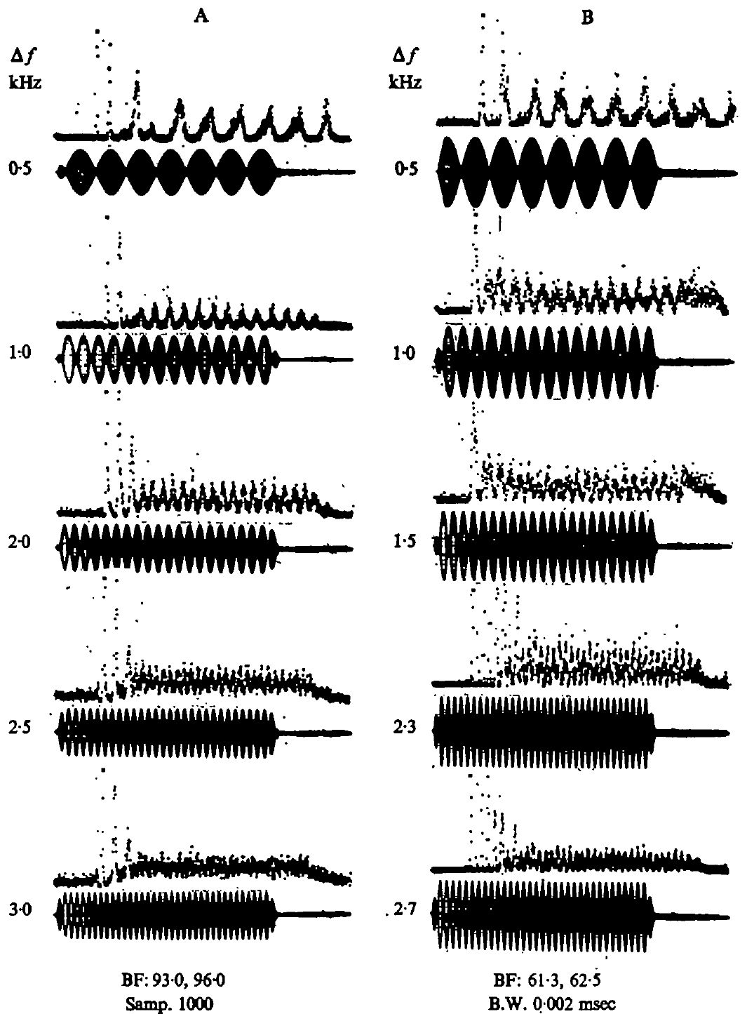
Peripheral impulses can track beats between nearby tones
Beats are periodic amplitude fluctuations produced when tones of slightly different frequency overlap. Suga and colleagues presented paired tones and recorded whether peripheral impulses followed the resulting fluctuations.
Phase locking means that discharge occurs at a consistent phase of a repeating stimulus feature. Peripheral neurons could phase-lock to beats up to about 3 kHz. Changing the separation between tones changed the rate of the amplitude fluctuations.
This timing code complements the code supplied by sharply tuned best frequencies. Overlapping emitted CF signals and returning echoes can provide beat information, and the impulse timing supplies information beyond the average number of impulses produced by a tone, a potential temporal representation of frequency difference.
Suga et al. (1975), Fig. 18(A–B). Peripheral impulse timing follows beat envelopes at different frequency separations.
Suga et al. (1975)
35
Notes:
• Two nearby tone frequencies produce a repeating change in their combined amplitude. Those fluctuations are beats. The experiment changed the difference between the tones and measured the times at which peripheral neurons discharged.
• Phase locking refers to a consistent relation between impulse timing and a phase of the repeating amplitude pattern. The neurons could follow beat rates up to approximately 3 kilohertz. Their impulse timing therefore supplied information beyond the average number of impulses produced by a tone.
• Suga and colleagues related this property to overlap between outgoing signals and echoes. That is a potential temporal representation of frequency difference, alongside the representation supplied by sharply tuned neurons. The laboratory recordings demonstrate the available peripheral signal; they do not select one exclusive behavioral cue for natural flight.
References:
Suga N, Simmons JA, Jen PH-S (1975). Peripheral specialization for fine analysis of Doppler-shifted echoes in the auditory system of the “CF-FM” bat Pteronotus parnellii. Journal of Experimental Biology 63(1):161–192. https://doi.org/10.1242/jeb.63.1.161
Figure: Suga et al. (1975), Fig. 18(A–B). Peripheral impulse timing follows beat envelopes at different frequency separations.
Figure source: https://doi.org/10.1242/jeb.63.1.161

Slide 47
Phase locking represents beat timing
Beats are periodic amplitude fluctuations produced when two tones of slightly different frequency overlap, and their rate depends on the separation between the two frequencies. Phase locking means that a neuron discharges at a consistent phase of a repeating stimulus feature.
Suga and colleagues presented paired tones and recorded whether peripheral impulses followed the resulting fluctuations. Peripheral neurons could phase-lock to beats up to about 3 kHz, so their impulse timing carried information beyond the average number of impulses produced by a tone.
The outgoing signal and its returning echo overlap in time and differ slightly in frequency, so they can produce beats. Phase-locked timing is a potential temporal representation of the frequency difference, alongside the representation supplied by sharply tuned neurons.
Suga et al. (1975), Fig. 18(A–B). Peripheral impulse timing follows beat envelopes at different frequency separations.
Suga et al. (1975)
35a
Notes:
• Timing and tuning are two ways of representing a frequency difference, and peripheral neurons in the paired-tone experiment carried timing information.
• Beats.
– Two nearby tone frequencies produce a repeating change in their combined amplitude.
– The experiment changed the difference between the tones and measured the times of neural discharge.
• Phase locking.
– Phase locking is a consistent relation between impulse timing and a phase of the repeating amplitude pattern.
– The neurons could follow beat rates up to approximately 3 kilohertz.
• Why it matters for echolocation.
– Suga and colleagues related the property to overlap between outgoing signals and echoes.
– The timing is a potential representation of frequency difference alongside the tuning of individual neurons.
• Laboratory signal.
– The timing signal is available in the periphery of the laboratory preparation.
• Beat rate.
– The beat rate depends on the separation between the two tone frequencies, so changing the separation changes how often the amplitude repeats.
• Timing beyond spike count.
– Impulse timing carried information beyond the average number of impulses produced by a tone.
– A temporal code and a tuning code can therefore represent the same frequency difference.
References:
Suga N, Simmons JA, Jen PH-S (1975). Peripheral specialization for fine analysis of Doppler-shifted echoes in the auditory system of the “CF-FM” bat Pteronotus parnellii. Journal of Experimental Biology 63(1):161–192. https://doi.org/10.1242/jeb.63.1.161

Slide 48
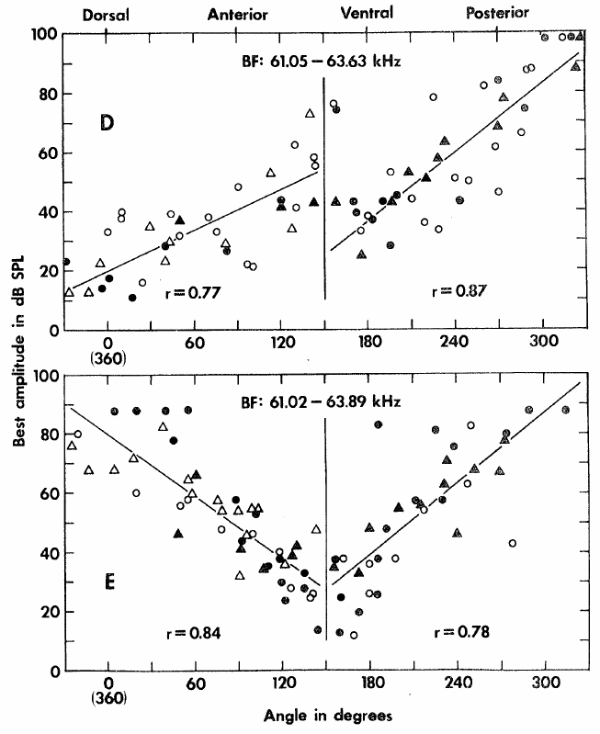
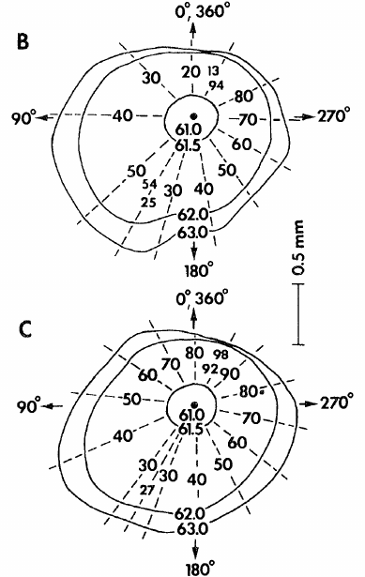
The cortex devotes extensive space to the CF echo band
The primary auditory cortex is a cortical region receiving organized auditory input. In Suga’s mustached-bat study, the Doppler-shifted-CF processing area occupied about 2.3 mm², approximately 30% of primary auditory cortex.
Its neurons were concentrated near the 61–63 kHz band associated with CF components of emitted signals and echoes. This large representation mirrors the peripheral specialization but adds cortical response properties beyond a neuron’s best frequency.
Tonotopy is an orderly representation of frequency across neural tissue. Suga examined how neurons sharing a best frequency differed in preferred sound amplitude. The enlarged CF region was not simply a collection of interchangeable neurons carrying identical information.
Suga (1977), Fig. 2(D–E). Measured best amplitude varies with cortical position, in dB SPL and degrees.
Suga (1977), Fig. 2(B–C). Original cortical maps, 0.5 mm.
Suga (1977)
36
Notes:
• The primary auditory cortex contains an organized representation of sound. Suga described an unusually large region concerned with the constant-frequency echo band of the mustached bat, occupying roughly 30 percent of that cortical area.
• Tonotopy means that frequency preference changes systematically with location. Within the enlarged CF region, many neurons could share similar best frequencies. The experiment therefore measured their response to sound amplitude as well as frequency.
• The cortical representation adds another dimension to the peripheral frequency code. The measured area and tuning describe auditory representation, not proof that this entire cortical region is necessary for every compensation response. Suga also cautioned that the region’s specialization does not exclude responses to signals other than orientation calls and their echoes.
References:
Suga N (1977). Amplitude Spectrum Representation in the Doppler-Shifted-CF Processing Area of the Auditory Cortex of the Mustache Bat. Science 196(4285):64–67. https://doi.org/10.1126/science.190681
Figure: Suga (1977), Fig. 2(D–E). Measured best amplitude varies with cortical position, in dB SPL and degrees.
Figure source: https://doi.org/10.1126/science.190681
Figure: Suga (1977), Fig. 2(B–C). Original cortical maps, 0.5 mm.
Figure source: https://doi.org/10.1126/science.190681

Slide 49
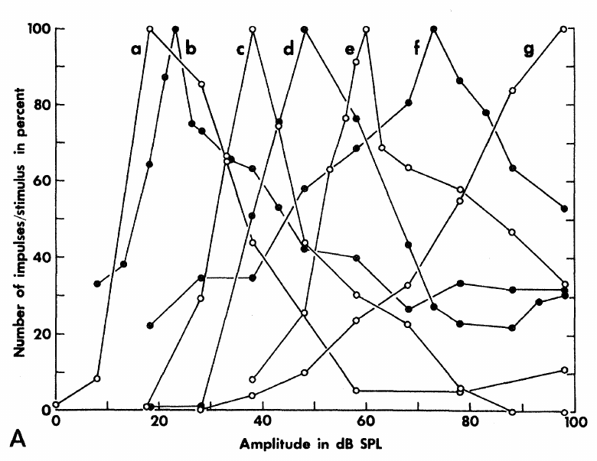
Some cortical neurons prefer an intermediate sound level
A neuron’s best amplitude is the sound pressure level producing its largest response. Suga measured impulse counts during 50 ms tones at each cortical neuron’s best frequency and compared response growth across sound levels.
Many CF-region neurons had nonmonotonic responses: impulse counts rose with amplitude, reached a maximum, then fell at stronger levels. Other neurons showed more nearly monotonic growth. Preferred amplitude therefore differed from minimum threshold.
An upper threshold marks a level above which excitation becomes weak or absent. These cortical response limits create amplitude selectivity that cannot be described solely as increasing discharge to louder sounds. Frequency and sound level jointly determine which cortical populations are most active.
Suga (1977), Fig. 1(A). Cortical impulse-count functions have different preferred sound levels.
Suga (1977)
37
Notes:
• The investigators held tone frequency at a neuron’s best frequency and increased sound level. Some neurons produced more impulses up to an intermediate amplitude, then produced fewer impulses as the sound became stronger.
• That rise followed by a fall is a nonmonotonic response. The amplitude giving the peak is the best amplitude. Minimum threshold is different: it identifies the weakest effective sound, not the level producing the maximum response.
• The loss of excitation at higher levels can create an upper threshold. Suga related this property to inhibitory interactions elsewhere in the auditory pathway. The cortical recordings establish level-selective response functions, while the origin of every neuron’s inhibitory input was not directly reconstructed in this mapping experiment.
References:
Suga N (1977). Amplitude Spectrum Representation in the Doppler-Shifted-CF Processing Area of the Auditory Cortex of the Mustache Bat. Science 196(4285):64–67. https://doi.org/10.1126/science.190681
Figure: Suga (1977), Fig. 1(A). Cortical impulse-count functions have different preferred sound levels.
Figure source: https://doi.org/10.1126/science.190681

Slide 50
Nonmonotonic responses create level selectivity
A neuron's best amplitude is the sound pressure level that produces its largest response, and it differs from the minimum threshold, which is the weakest effective sound. A nonmonotonic response rises with sound level, reaches a maximum and then falls at stronger levels.
Suga held tone frequency at each cortical neuron's best frequency and counted impulses during 50-ms tones as the level increased. Many CF-region neurons were nonmonotonic, whereas other neurons showed more nearly monotonic growth.
The fall in response at higher levels creates an upper threshold, above which excitation becomes weak or absent. Such neurons are selective for an intermediate level, so frequency and sound level jointly determine which cortical populations are most active.
Suga (1977), Fig. 1(A). Cortical impulse-count functions have different preferred sound levels.
Suga (1977)
37a
Notes:
• A neuron that responds most to an intermediate level reports amplitude by its response and not simply by louder meaning more.
• Defining the terms.
– The best amplitude is the level giving the peak response.
– The minimum threshold is the weakest sound that evokes a response and is a different quantity.
• The measurement.
– Tone frequency was held at the neuron's best frequency while sound level increased.
– Some neurons produced more impulses up to an intermediate amplitude and fewer at stronger levels.
• The upper threshold.
– The loss of excitation at higher levels creates an upper threshold.
– Suga related this property to inhibitory interactions elsewhere in the auditory pathway.
• Neuron variety.
– Other neurons showed more nearly monotonic growth, so the CF region contains neurons with different level functions.
• Best amplitude and threshold.
– Best amplitude is the level that gives the largest response, and the minimum threshold is the weakest effective level.
– The two are different properties of a neuron.
• Level selectivity.
– A nonmonotonic neuron falls silent or weak above its best level, so it prefers an intermediate level.
– Frequency and level together determine which cortical populations are most active.
References:
Suga N (1977). Amplitude Spectrum Representation in the Doppler-Shifted-CF Processing Area of the Auditory Cortex of the Mustache Bat. Science 196(4285):64–67. https://doi.org/10.1126/science.190681

Slide 51
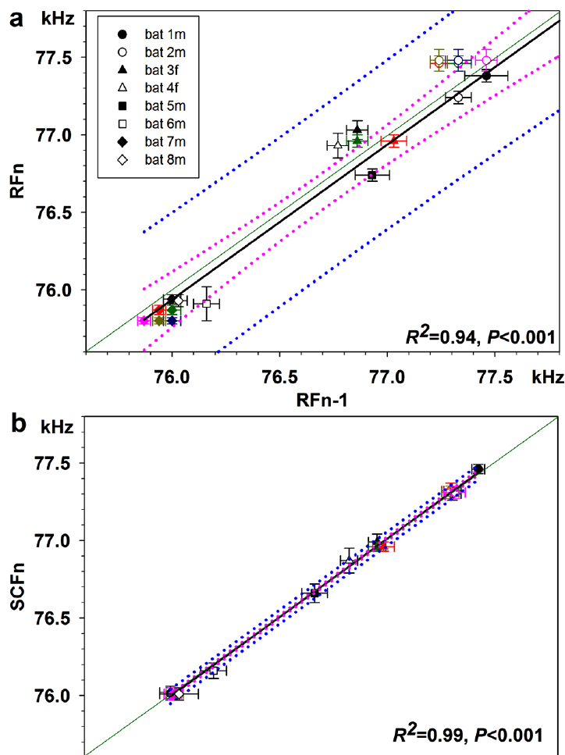
Communication calls need not share echolocation feedback
Liu and colleagues compared resting echolocation calls with short constant-frequency communication calls in greater horseshoe bats. These social calls resembled shortened CF signals but occurred during interactions between bats. Recording both call types across days tested whether similar acoustic signals shared the same frequency stability.
Resting echolocation frequency varied across days, whereas the communication-call frequency remained much more stable. Typical call durations also differed: resting echolocation calls were approximately 47 ms, while the short social calls were approximately 14 ms. Frequency regulation therefore depended on vocal context rather than acoustic similarity alone.
The authors proposed different feedback control for echolocation and communication, possibly including reduced or absent auditory feedback for the social calls. The stable frequency of the communication calls supports the proposal that their control differs from that of echolocation calls, with frequency regulation depending on vocal context instead of acoustic similarity alone.
Liu et al. (2013), Fig. 2(A–B). Daily frequency comparisons for echolocation and social calls.
Liu et al. (2013)
38
Notes:
• Liu and colleagues compared resting echolocation calls with short constant-frequency communication calls in greater horseshoe bats. These social calls resembled shortened CF signals but occurred during interactions between bats. Recording both call types across days tested whether similar acoustic signals shared the same frequency stability.
• Resting echolocation frequency varied across days, whereas the communication-call frequency remained much more stable. Typical call durations also differed: resting echolocation calls were approximately 47 ms, while the short social calls were approximately 14 ms. Frequency regulation therefore depended on vocal context rather than acoustic similarity alone.
• The authors proposed different feedback control for echolocation and communication, possibly including reduced or absent auditory feedback for the social calls. The stable frequency of the communication calls supports the proposal that their control differs from that of echolocation calls, with frequency regulation depending on vocal context instead of acoustic similarity alone.
References:
Liu Y, Feng J, Metzner W (2013). Different auditory feedback control for echolocation and communication in horseshoe bats. PLoS ONE 8(4):e62710. https://doi.org/10.1371/journal.pone.0062710
Figure: Liu et al. (2013), Fig. 2(A–B). Daily frequency comparisons for echolocation and social calls.
Figure source: https://doi.org/10.1371/journal.pone.0062710

Slide 52
Amplitude and frequency occupy cortical coordinates
Amplitopic representation is an orderly spatial organization of preferred sound amplitude. In Suga’s mapped CF processing area, best-frequency contours and best-amplitude contours followed different directions across the cortical surface.
The best-amplitude organization varied among animals. The posterior region consistently placed larger preferred amplitudes dorsally, whereas the anterior region could follow either of two arrangements. The data support structured amplitude representation without a single identical map in every bat.
Preferred amplitudes of about 30–50 dB SPL occupied more cortical area than preferred amplitudes of about 80–100 dB SPL. This unequal allocation gives more space to intermediate preferred sound levels, and the author proposed a relation to the amplitudes of echoes commonly used in echolocation.
Suga (1977), Fig. 2(D–E). Measured best amplitude varies with cortical position, in dB SPL and degrees.
Suga (1977), Fig. 2(B–C). Original cortical maps, 0.5 mm.
Suga (1977)
39
Notes:
• Amplitopy refers to a spatial ordering of preferred sound level, just as tonotopy refers to a spatial ordering of preferred frequency. The two properties do not have to change along the same direction across the cortical surface.
• Suga found a systematic relation between location and best amplitude, but the arrangement was not identical across all animals. Two patterns were described in the anterior part of the CF processing area, while the posterior pattern was more consistent.
• The maps gave more space to intermediate preferred sound levels than to very high preferred levels. The author proposed a relation to the amplitudes of echoes commonly used in echolocation. The mapping experiment measured neural preference and location; it did not independently sample the complete distribution of echoes encountered by a bat in nature.
References:
Suga N (1977). Amplitude Spectrum Representation in the Doppler-Shifted-CF Processing Area of the Auditory Cortex of the Mustache Bat. Science 196(4285):64–67. https://doi.org/10.1126/science.190681
Figure: Suga (1977), Fig. 2(D–E). Measured best amplitude varies with cortical position, in dB SPL and degrees.
Figure source: https://doi.org/10.1126/science.190681
Figure: Suga (1977), Fig. 2(B–C). Original cortical maps, 0.5 mm.
Figure source: https://doi.org/10.1126/science.190681

Slide 53
Free flight lowers emission while preserving echo frequency
Schoeppler and colleagues studied Hipposideros armiger flying toward a landing grid. They recorded echolocation signals, reconstructed the flight trajectory, and calculated the frequency of echoes from targets ahead using the measured flight speed.
During acceleration, emitted CF2 frequency decreased. In a representative flight, the minimum emission frequency coincided with a maximum speed of 4.7 m/s. The calculated returning frequency remained close to the animal’s reference band.
This separates the changing outgoing signal from the controlled echo estimate. The echo frequency was calculated from the recorded call frequency and the reconstructed flight kinematics, so natural flight supplies a counterpart to the playback experiments, and the calculated echo frequency changed far less than the emitted frequency.
Schoeppler et al. (2018), Fig. 2(e–f). Measured emission and flight speed, with calculated echo frequency.
Schoeppler et al. (2018)
40
Notes:
• The bats flew toward a grid while calls and flight trajectories were recorded. The reconstruction supplied speed, and the investigators used that speed together with the emitted frequency to calculate the expected Doppler-shifted echo frequency.
• The emitted second-harmonic CF frequency fell as the bat accelerated. In the example flight, the lowest emission coincided with a speed of 4.7 metres per second. The calculated echo frequency changed far less than the emitted frequency.
• The result supplies a natural-flight counterpart to playback experiments. Its echo measure remains an estimate based on recorded calls and reconstructed movement. The method does not directly measure cochlear stimulation, and the distinction between recorded emission and calculated echo frequency is necessary when assessing the evidence for compensation precision.
References:
Schoeppler D, Schnitzler H-U, Denzinger A (2018). Precise Doppler shift compensation in the hipposiderid bat, Hipposideros armiger. Scientific Reports 8:4598. https://doi.org/10.1038/s41598-018-22880-y
Figure: Schoeppler et al. (2018), Fig. 2(e–f). Measured emission and flight speed, with calculated echo frequency.
Figure source: https://doi.org/10.1038/s41598-018-22880-y

Slide 54
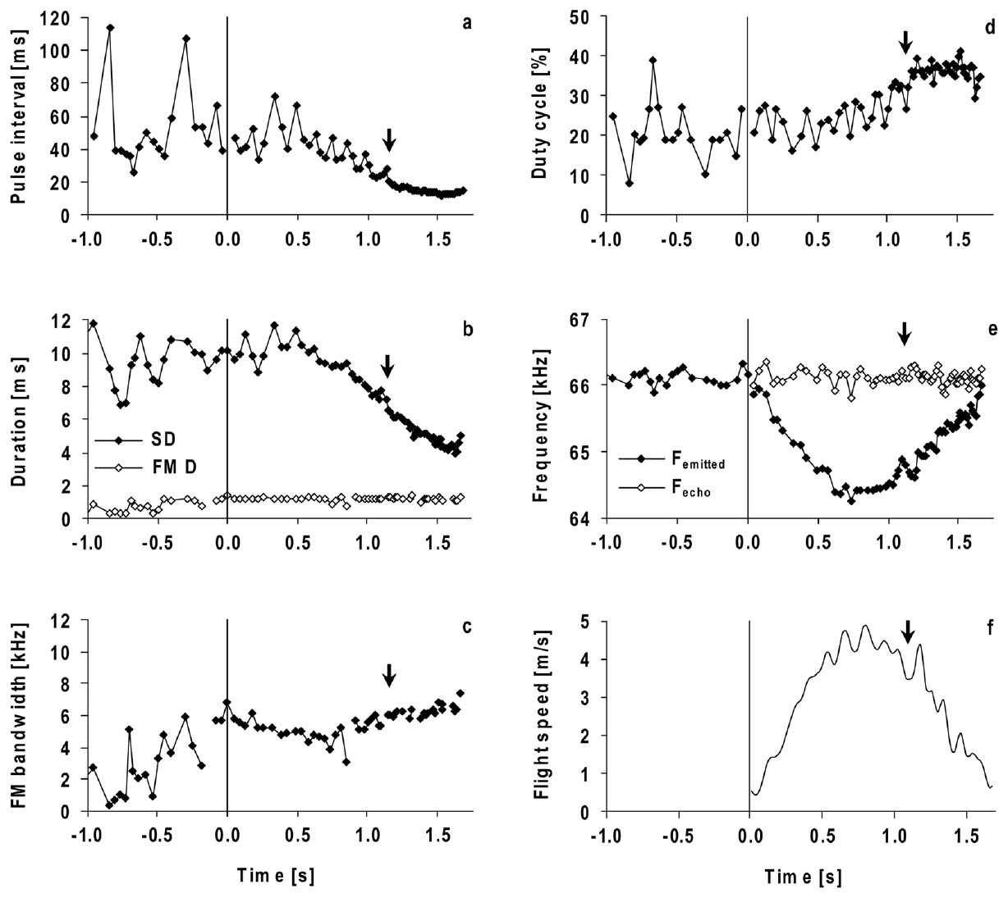
Approach changes call timing while CF is retained
Pulse interval is the time between consecutive calls; duty cycle is the proportion of time occupied by sound emission. Both describe how frequently a bat samples its surroundings, independently of CF frequency.
In H. armiger, pulse intervals and call durations decreased toward landing. During the final approach, mean call duration reached about 3–4 ms and pulse interval about 11–12 ms. Duty cycle increased, while the CF component remained present.
Frequency compensation therefore operates within an acoustic sequence whose temporal structure is also changing. The terminal approach is not a sequence of otherwise identical calls. Timing, harmonic prominence, and the FM component can change while the returning CF band remains regulated.
Schoeppler et al. (2018), Fig. 2(a–f). Call timing, FM properties, duty cycle, and compensation during approach.
Schoeppler et al. (2018)
41
Notes:
• Pulse interval measures the time from one call to the next. Duty cycle measures how much of the sequence is occupied by emitted sound. Shortening intervals and shortening calls can change duty cycle in different ways, so all three quantities must be measured.
• The Hipposideros armiger calls became shorter and more closely spaced near the landing grid. The final approach included calls of roughly 3 to 4 milliseconds and intervals of roughly 11 to 12 milliseconds. The sustained CF component was retained.
• The bat was therefore changing the timing of sampling at the same time that it controlled frequency. These measurements describe flight toward a landing target, not prey capture. The frequency, duration, interval, and harmonic changes belong to the observed approach behavior and should not be treated as identical results for every hunting situation.
References:
Schoeppler D, Schnitzler H-U, Denzinger A (2018). Precise Doppler shift compensation in the hipposiderid bat, Hipposideros armiger. Scientific Reports 8:4598. https://doi.org/10.1038/s41598-018-22880-y
Figure: Schoeppler et al. (2018), Fig. 2(a–f). Call timing, FM properties, duty cycle, and compensation during approach.
Figure source: https://doi.org/10.1038/s41598-018-22880-y

Slide 55
Pulse interval and duty cycle describe sampling
Pulse interval is the time between consecutive calls, and duty cycle is the proportion of time occupied by sound emission. Both describe how often a bat samples its surroundings and can change independently of the CF frequency.
In Hipposideros armiger, call duration reached about 3–4 ms and pulse interval about 11–12 ms during the final approach to the landing grid. Shortening intervals and shortening calls change duty cycle in different ways, so all three quantities must be measured, and the duty cycle increased during approach.
The sustained CF component was retained while the timing of sampling changed. The bat therefore controlled the returning CF frequency within an acoustic sequence whose temporal structure, harmonic prominence and FM component were also changing.
Schoeppler et al. (2018), Fig. 2(a–f). Call timing, FM properties, duty cycle, and compensation during approach.
Schoeppler et al. (2018)
41a
Notes:
• A bat changes how often it samples and how long each call lasts at the same time that it holds the echo frequency near its reference.
• Definitions.
– Pulse interval measures the time from one call to the next.
– Duty cycle measures how much of the sequence is occupied by emitted sound.
• Approach to the landing grid.
– Calls became shorter and more closely spaced, with durations of roughly 3 to 4 milliseconds and intervals of roughly 11 to 12 milliseconds.
– The sustained CF component was retained.
• Why three measures.
– Shortening intervals and shortening calls can change duty cycle in different ways.
– Duration, interval and duty cycle are therefore measured separately.
• Scope.
– These measurements describe flight toward a landing target and not prey capture.
• Timing of sampling.
– Call duration reached about 3 to 4 milliseconds and pulse interval about 11 to 12 milliseconds near the landing grid.
– Duty cycle increased during approach.
• Independent controls.
– Pulse interval and duty cycle can change independently of the CF frequency, so the bat regulates echo frequency while its temporal sampling changes.
References:
Schoeppler D, Schnitzler H-U, Denzinger A (2018). Precise Doppler shift compensation in the hipposiderid bat, Hipposideros armiger. Scientific Reports 8:4598. https://doi.org/10.1038/s41598-018-22880-y

Slide 56
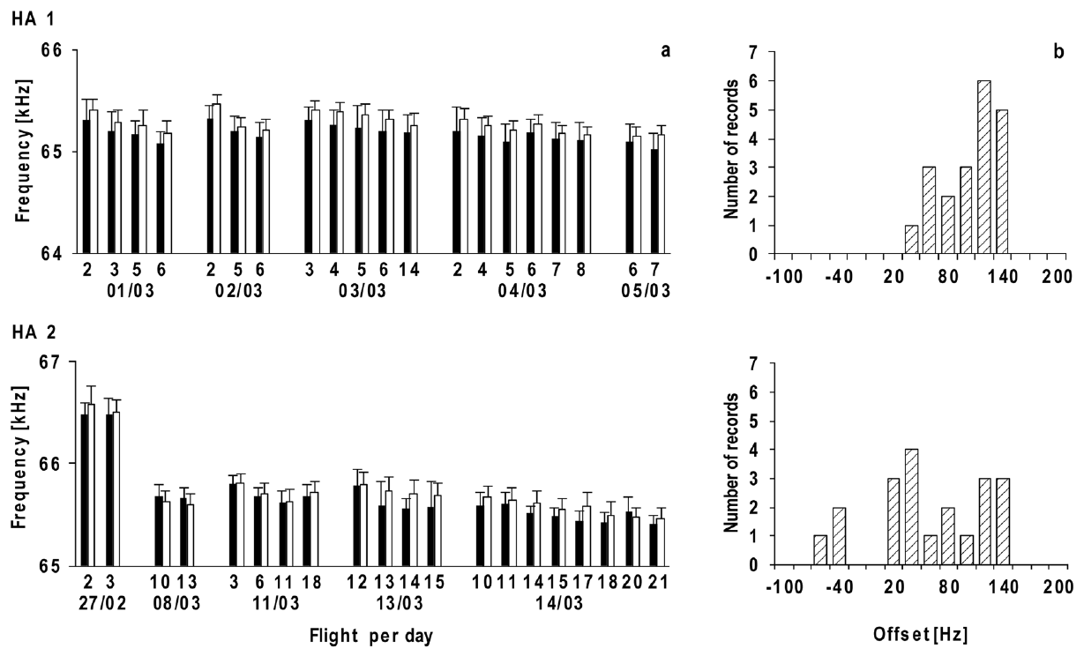
Resting and reference frequencies shift together
Schoeppler and colleagues measured resting frequency immediately before each flight and reference frequency from the corresponding calculated echoes. The absolute values changed between flights and across recording days, rather than remaining permanently fixed.
The two frequencies remained closely coupled. Their mean offset was about 80 Hz, with the reference usually above the resting frequency. In one bat, reference frequency declined by about 1 kHz over nine days.
The investigators paired the resting call series measured just before take-off with the echo estimate from that particular flight, because both frequencies can change across time. A precise control system can track a preferred state that itself changes, and a contemporaneous baseline distinguishes movement of the preferred band from error around that band.
Schoeppler et al. (2018), Fig. 3(a–b). Paired resting and reference frequencies and their offsets across flights.
Schoeppler et al. (2018)
42
Notes:
• The investigators measured the resting call series just before take-off and paired it with the echo estimate from that particular flight. This pairing matters because both frequencies can change across time.
• The resting and reference values usually moved in the same direction. Their mean separation remained approximately 80 hertz even though one animal’s reference frequency declined by about a kilohertz over nine days.
• A precise control system can track a preferred state that itself changes. Using a resting value from an earlier session would mix that shift with the actual compensation offset. The observed coupling is therefore more informative than asking whether every call remains at one absolute frequency for the lifetime of an individual bat.
References:
Schoeppler D, Schnitzler H-U, Denzinger A (2018). Precise Doppler shift compensation in the hipposiderid bat, Hipposideros armiger. Scientific Reports 8:4598. https://doi.org/10.1038/s41598-018-22880-y
Figure: Schoeppler et al. (2018), Fig. 3(a–b). Paired resting and reference frequencies and their offsets across flights.
Figure source: https://doi.org/10.1038/s41598-018-22880-y

Slide 57
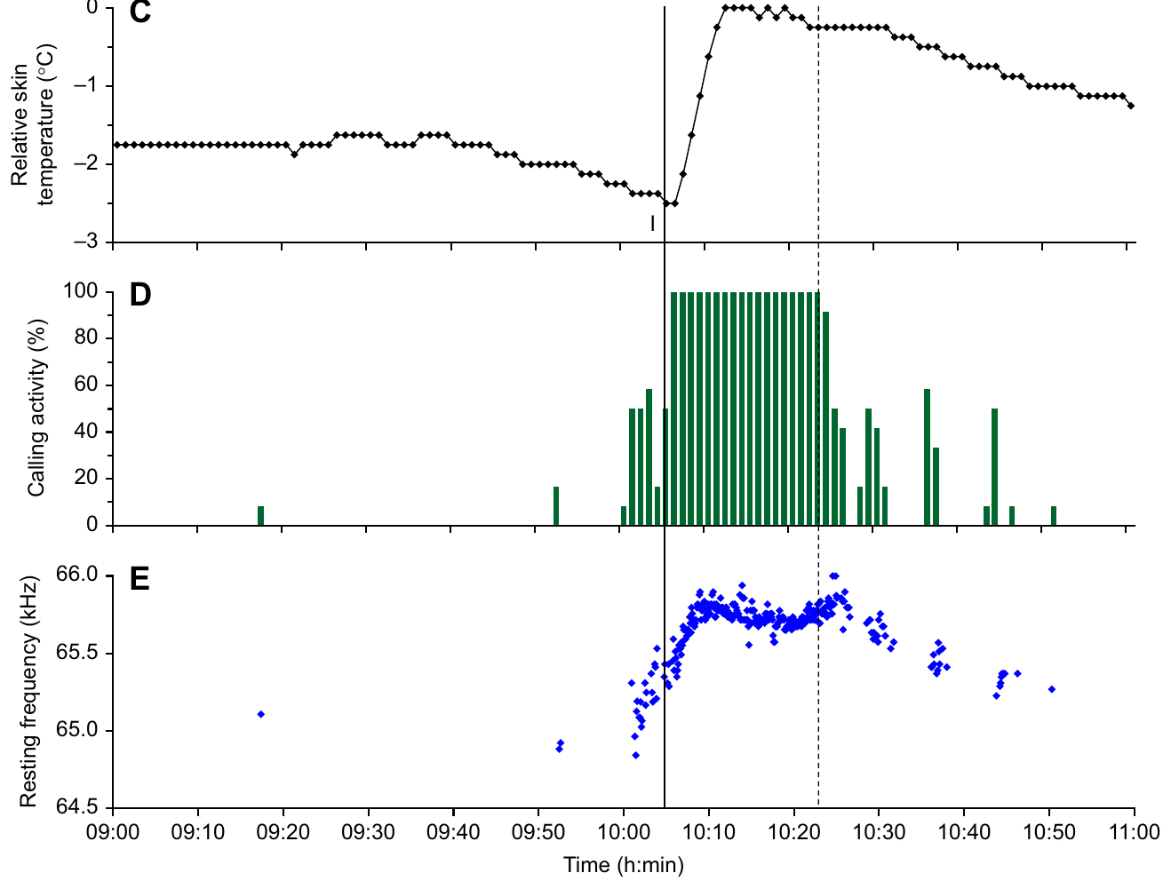
Resting call frequency rises as torpid bats warm
Torpor is a state of reduced physiological activity associated here with lower temperature. Schoeppler and colleagues attached a miniature logger between the shoulder blades of H. armiger and recorded skin temperature together with echolocation calls.
After the experimenter entered the room, resting bats became more active, warmed, and increased their CF2 resting frequency. The largest frequency rise during activation reached about 1.44 kHz. The change occurred without a flight-induced Doppler shift.
The experiment links physiological state to the frequency emitted at rest. The logger measured skin temperature, an indirect indicator of internal temperature, and activation changes more than temperature alone, so the resting-frequency baseline can vary even when the animal is stationary.
Schoeppler et al. (2022), Fig. 2(C–E). Skin temperature, calling activity, and resting CF2 frequency during activation.
Schoeppler et al. (2022)
43
Notes:
• Torpor involves reduced physiological activity and, in these recordings, a lower temperature before activation. The investigators measured skin temperature with a small logger on the back and recorded ultrasonic calls at the same time.
• Entering the room elicited increased calling and warming. As the bats activated, the frequency of their resting second-harmonic CF component rose, in some cases by as much as 1.44 kilohertz. Because these were resting calls, the change could not be assigned to compensation for flight speed.
• The paired recordings connect call frequency with physiological state. Skin temperature is an indirect indicator of internal temperature, and activation changes more than temperature alone. The measurements support a state-dependent shift of the resting band without directly proving how the temperature of the cochlear resonator changed.
References:
Schoeppler D, Denzinger A, Schnitzler H-U (2022). The resting frequency of echolocation signals changes with body temperature in the hipposiderid bat Hipposideros armiger. Journal of Experimental Biology 225(3):jeb243569. https://doi.org/10.1242/jeb.243569
Figure: Schoeppler et al. (2022), Fig. 2(C–E). Skin temperature, calling activity, and resting CF2 frequency during activation.
Figure source: https://doi.org/10.1242/jeb.243569

Slide 58
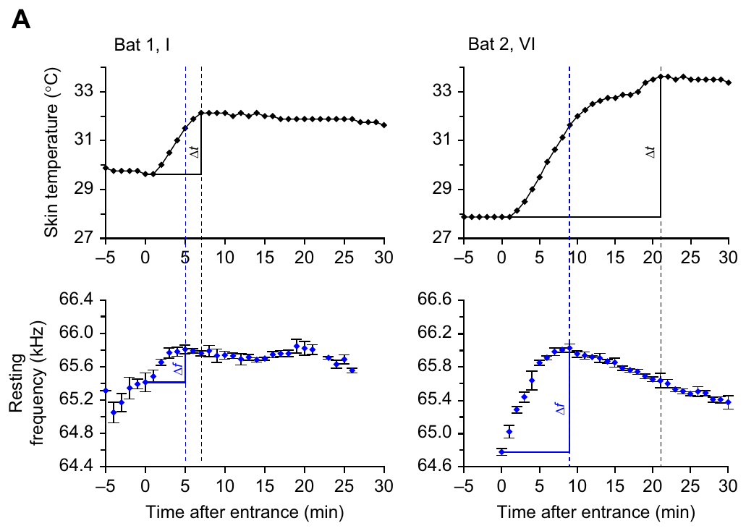
Frequency can peak before measured skin temperature
Schoeppler and colleagues compared the time of maximum resting frequency with the time of maximum skin temperature during activation. The frequency maximum generally occurred earlier, while skin temperature continued increasing.
After the skin-temperature maximum, both temperature and resting frequency tended to decline. The timing difference prevents a simple conversion of every skin-temperature change into a fixed frequency change throughout warming and cooling.
The authors discussed delayed warming of skin relative to internal tissues as one explanation. Internal tissues could warm earlier than the skin, and the later decline in both quantities supports their association while the temporal difference between their peaks remains.
Schoeppler et al. (2022), Fig. 3(A). Resting-frequency and skin-temperature peaks differ in time during activation.
Schoeppler et al. (2022)
44
Notes:
• The two signals were recorded together, but their peaks were not simultaneous. The bat’s resting frequency usually reached a maximum before the temperature measured at the skin reached its maximum.
• A sensor on the back does not necessarily follow the temperature inside the cochlea with the same timing. Internal tissues could warm earlier than the skin, but that possibility was not directly tested with a cochlear temperature probe.
• The later decline in both quantities supports their association while preserving the temporal difference. It would be incorrect to assign a universal kilohertz-per-degree conversion from these skin recordings. The source explicitly distinguishes its measured skin temperature from the unmeasured temperature at the inner-ear resonator.
References:
Schoeppler D, Denzinger A, Schnitzler H-U (2022). The resting frequency of echolocation signals changes with body temperature in the hipposiderid bat Hipposideros armiger. Journal of Experimental Biology 225(3):jeb243569. https://doi.org/10.1242/jeb.243569
Figure: Schoeppler et al. (2022), Fig. 3(A). Resting-frequency and skin-temperature peaks differ in time during activation.
Figure source: https://doi.org/10.1242/jeb.243569

Slide 59
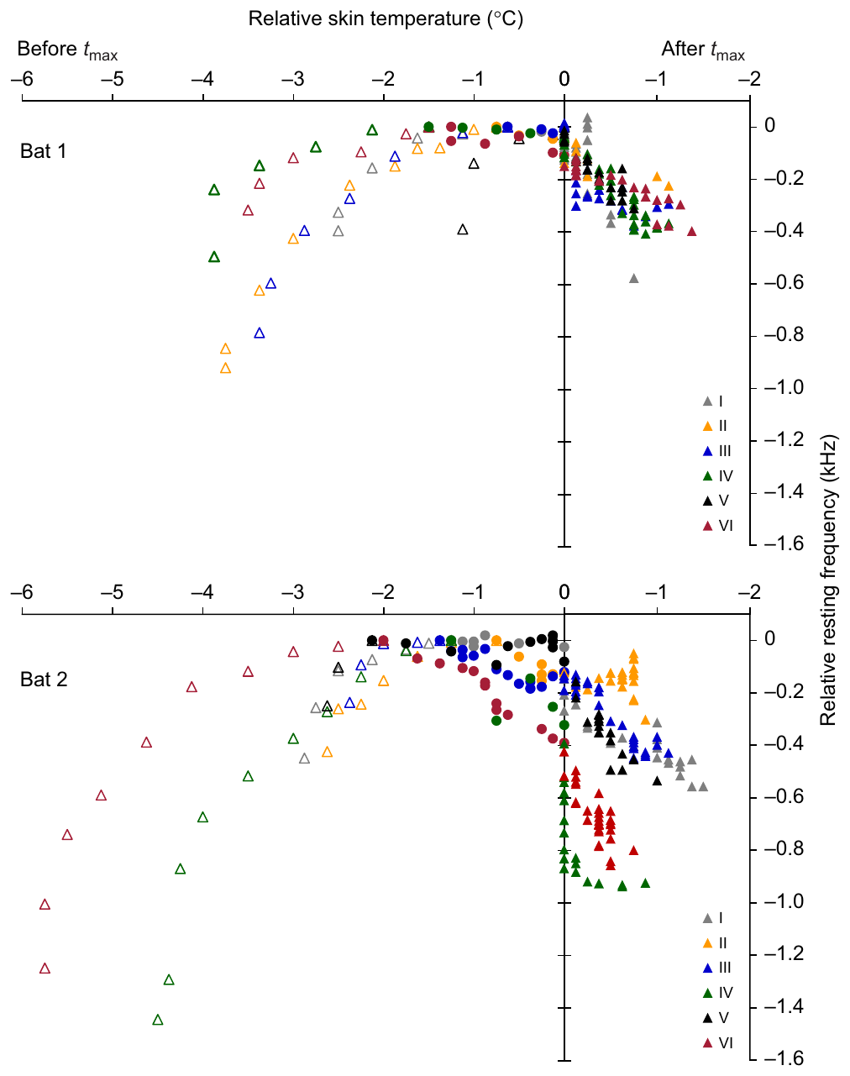
A changing sensory band can coexist with precise feedback
State-dependent resting-frequency changes and the coupling of resting and reference frequencies support an adaptive operating band: the feedback system can regulate around a preferred frequency that changes with the animal’s physiological state.
Schoeppler and colleagues proposed that the controlled variable is activation of the cochlear foveal resonance system. Afferent pathways carry sensory activity toward control centers; efferent pathways carry motor commands toward the vocal apparatus, changing the next emitted call.
Afferent input carries sensory information into the nervous system, and efferent output changes the vocal apparatus, so the new call changes the acoustic feedback returning to the ear. The directly observed findings are the change in resting frequency, its relation to skin temperature and the coupling of resting and reference frequencies, and together the behavioral and peripheral studies constrain how a moving sensory target can remain compatible with precise echo regulation.
Schoeppler et al. (2022), Fig. 5. Resting frequency covaries with skin temperature across activation and recovery.
Schoeppler et al. (2022); Schoeppler et al. (2018); Metzner et al. (2002)
45
Notes:
• The preferred acoustic band is not necessarily fixed permanently. The temperature study found state-linked changes in resting calls, and the flight study found that resting and reference frequencies remain coupled when their absolute values shift.
• The authors proposed regulation of activity in the cochlear resonance system. Afferent input carries sensory information into the nervous system. Efferent output changes the vocal apparatus, and the new call changes the acoustic feedback returning to the ear.
• That account connects the measured observations, but the warming experiment did not directly record the cochlear activity being proposed as the controlled variable. The strongest established claims remain the change in resting frequency, the relation to skin temperature, and the coupling of resting and reference frequencies measured in the separate flight study. Precise regulation and a changing preferred band are compatible.
References:
Schoeppler D, Denzinger A, Schnitzler H-U (2022). The resting frequency of echolocation signals changes with body temperature in the hipposiderid bat Hipposideros armiger. Journal of Experimental Biology 225(3):jeb243569. https://doi.org/10.1242/jeb.243569
Schoeppler D, Schnitzler H-U, Denzinger A (2018). Precise Doppler shift compensation in the hipposiderid bat, Hipposideros armiger. Scientific Reports 8:4598. https://doi.org/10.1038/s41598-018-22880-y
Metzner W, Zhang S, Smotherman M (2002). Doppler-shift compensation behavior in horseshoe bats revisited: auditory feedback controls both a decrease and an increase in call frequency. Journal of Experimental Biology 205(11):1607–1616. https://doi.org/10.1242/jeb.205.11.1607
Figure: Schoeppler et al. (2022), Fig. 5. Resting frequency covaries with skin temperature across activation and recovery.
Figure source: https://doi.org/10.1242/jeb.243569

Slide 60
Key takeaways
Echo frequency is the controlled signal. CF-FM bats lower emitted CF frequency as approach raises echo frequency, maintaining echoes near an individual reference band.
Resting and reference frequencies differ. The resting emission baseline usually lies slightly below the compensated echo reference; their offset must be measured at the same time.
Audible feedback acts in both directions. Horseshoe bats lower calls for higher echoes and can raise calls for sufficiently audible lower echoes, with unequal correction ranges.
The auditory fovea begins peripherally. Cochlear resonance and sharply tuned peripheral neurons concentrate sensitivity and selectivity near the CF2 echo band.
Neural codes include timing and population location. Midbrain neurons can retain narrow duration tuning near resonance; cortical populations organize frequency and preferred amplitude.
Precision can track a changing operating band. Resting and reference frequencies can shift together, and resting calls change during warming without a flight-induced Doppler shift.
Suga et al. (1975); Suga (1977); Schuller et al. (1974); Metzner et al. (2002); Schoeppler et al. (2018, 2022)
46
Notes:
Teaching transcript:
• Echo frequency is the controlled signal. CF-FM bats lower emitted CF frequency as approach raises echo frequency, maintaining echoes near an individual reference band.
• Resting and reference frequencies differ. The resting emission baseline usually lies slightly below the compensated echo reference; their offset must be measured at the same time.
• Audible feedback acts in both directions. Horseshoe bats lower calls for higher echoes and can raise calls for sufficiently audible lower echoes, with unequal correction ranges.
• The auditory fovea begins peripherally. Cochlear resonance and sharply tuned peripheral neurons concentrate sensitivity and selectivity near the CF2 echo band.
• Neural codes include timing and population location. Midbrain neurons can retain narrow duration tuning near resonance; cortical populations organize frequency and preferred amplitude.
• Precision can track a changing operating band. Resting and reference frequencies can shift together, and resting calls change during warming without a flight-induced Doppler shift.
References:
Long GR, Schnitzler H-U (1975). Behavioural audiograms from the bat, Rhinolophus ferrumequinum. Journal of Comparative Physiology 100:211–219. https://doi.org/10.1007/BF00614531
Suga N, Simmons JA, Jen PH-S (1975). Peripheral specialization for fine analysis of Doppler-shifted echoes in the auditory system of the “CF-FM” bat Pteronotus parnellii. Journal of Experimental Biology 63(1):161–192. https://doi.org/10.1242/jeb.63.1.161
Suga N (1977). Amplitude Spectrum Representation in the Doppler-Shifted-CF Processing Area of the Auditory Cortex of the Mustache Bat. Science 196(4285):64–67. https://doi.org/10.1126/science.190681
Schuller G, Beuter K, Schnitzler H-U (1974). Response to frequency shifted artificial echoes in the bat Rhinolophus ferrumequinum. Journal of Comparative Physiology 89(3):275–286. https://doi.org/10.1007/BF00696191
Metzner W, Zhang S, Smotherman M (2002). Doppler-shift compensation behavior in horseshoe bats revisited: auditory feedback controls both a decrease and an increase in call frequency. Journal of Experimental Biology 205(11):1607–1616. https://doi.org/10.1242/jeb.205.11.1607
Schoeppler D, Schnitzler H-U, Denzinger A (2018). Precise Doppler shift compensation in the hipposiderid bat, Hipposideros armiger. Scientific Reports 8:4598. https://doi.org/10.1038/s41598-018-22880-y
Schoeppler D, Denzinger A, Schnitzler H-U (2022). The resting frequency of echolocation signals changes with body temperature in the hipposiderid bat Hipposideros armiger. Journal of Experimental Biology 225(3):jeb243569. https://doi.org/10.1242/jeb.243569
Wang X, Bao M, Wang H, Sun R, Dai W, Sun K, Zhu Y, Pu Y, Chu Y, Li X, Wang T, Zhang M, Lin A, Li J, Feng J (2025). Cochlear Cell Atlas of Two Laryngeal Echolocating Bats—New Evidence for the Adaptive Nervous Physiology in Constant Frequency Bat. Molecular Ecology Resources 25:e14101. https://doi.org/10.1111/1755-0998.14101
Macías S, Hechavarría JC, Kössl M (2016). Sharp temporal tuning in the bat auditory midbrain overcomes spectral-temporal trade-off imposed by cochlear mechanics. Scientific Reports 6:29129. https://doi.org/10.1038/srep29129
Liu Y, Feng J, Metzner W (2013). Different auditory feedback control for echolocation and communication in horseshoe bats. PLoS ONE 8(4):e62710. https://doi.org/10.1371/journal.pone.0062710

