Slide 1
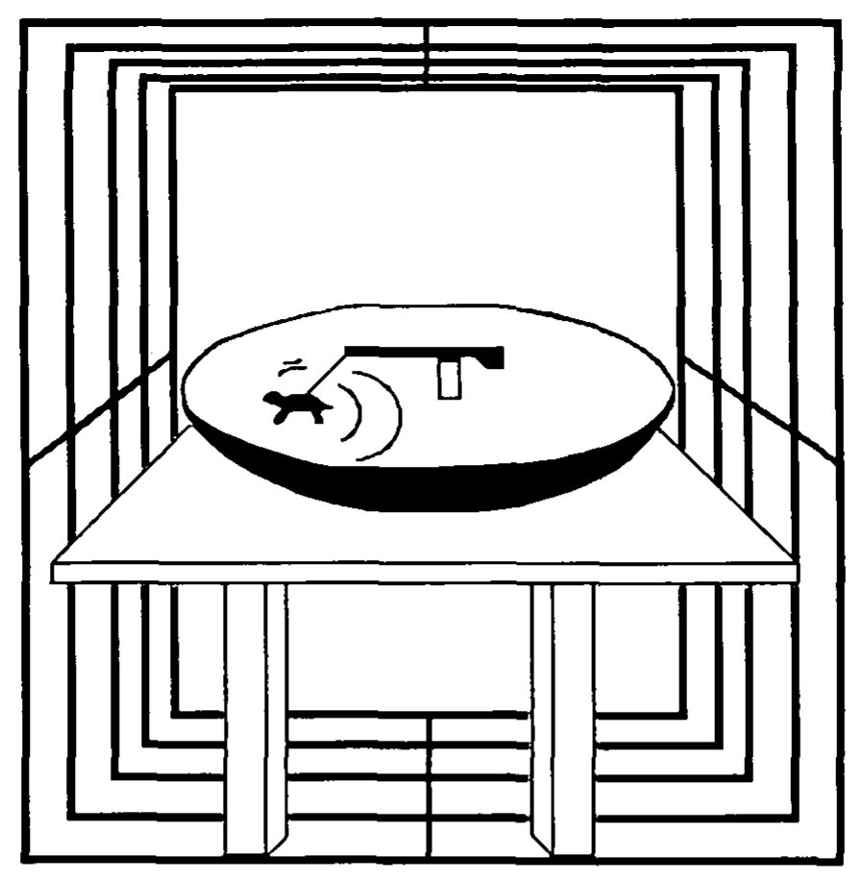
NEUR 411 · NEUROETHOLOGY · FALL 2026
Lecture 23
Magnetoreception: sea turtle and migratory bird magnetic compasses
Monday, October 19, 2026
Jordan Lopez, Ph.D.
Professor of Neurobiology & Biomedical Engineering
Lohmann (1991), Fig. 1. Published drawing of the loggerhead hatchling and swimming preparation.
Notes:
Magnetoreception: sea turtle and migratory bird magnetic compasses
Lecture 23. NEUR 411 · NEUROETHOLOGY · FALL 2026. Monday, October 19, 2026.
Figure: Lohmann (1991), Fig. 1. Published drawing of the loggerhead hatchling and swimming preparation.
Figure source: https://doi.org/10.1242/jeb.155.1.37
• Loggerhead hatchlings can orient in Earth-strength magnetic fields before ocean experience. The title figure shows the original turtle orientation preparation from Lohmann (1991).
References:
Lohmann KJ (1991). Magnetic Orientation By Hatchling Loggerhead Sea Turtles (Caretta Caretta). Journal of Experimental Biology 155(1):37-49. https://doi.org/10.1242/jeb.155.1.37

Slide 2
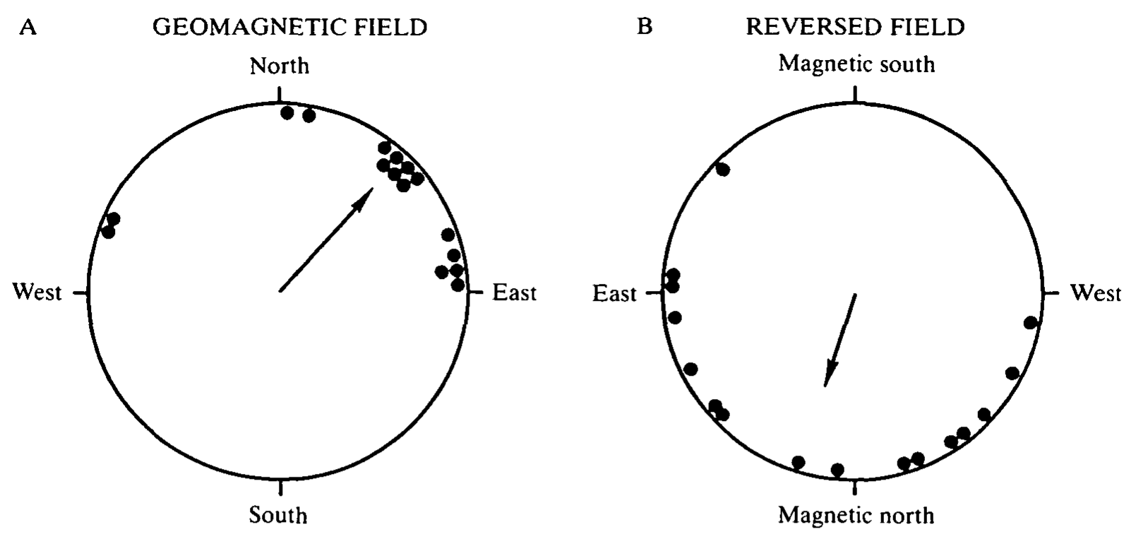
Hatchling turtles orient to the magnetic field
Magnetoreception is the detection of magnetic fields. Loggerhead sea turtles, Caretta caretta, leave their nesting beach before navigating offshore. Lohmann tested whether newly emerged hatchlings could derive a swimming direction from Earth-strength magnetic fields when visible landmarks were unavailable.
Hatchlings swam in a harness connected to a freely rotating lever. A rheostat converted lever position into an electrical record of heading. After exposure to a dim eastern light, turtles swam for 90–180 min in complete darkness under either the natural field or an experimentally reversed horizontal component.
The natural-field group preferred 42°, whereas the reversed-field group preferred 196°. The field manipulation therefore changed the directional response. Magnetic influence on orientation was therefore demonstrated in a preparation in which visible landmarks were unavailable and the magnetic field was the controlled variable.
Lohmann (1991), Fig. 2(A–B). Magnetic reversal shifts the preferred swimming direction.
Lohmann (1991)
02
Notes:
• Magnetoreception is the detection of magnetic fields. Loggerhead sea turtles, Caretta caretta, leave their nesting beach before navigating offshore. Lohmann tested whether newly emerged hatchlings could derive a swimming direction from Earth-strength magnetic fields when visible landmarks were unavailable.
– A compass provides direction rather than location. The light exposure preceding the dark test is part of the preparation, so the result cannot be interpreted as magnetic orientation without any previous visual experience.
• Hatchlings swam in a harness connected to a freely rotating lever. A rheostat converted lever position into an electrical record of heading. After exposure to a dim eastern light, turtles swam for 90–180 min in complete darkness under either the natural field or an experimentally reversed horizontal component.
• The natural-field group preferred 42°, whereas the reversed-field group preferred 196°. The field manipulation therefore changed the directional response. Magnetic influence on orientation was therefore demonstrated in a preparation in which visible landmarks were unavailable and the magnetic field was the controlled variable.
References:
Lohmann KJ (1991). Magnetic Orientation By Hatchling Loggerhead Sea Turtles (Caretta Caretta). Journal of Experimental Biology 155(1):37-49. https://doi.org/10.1242/jeb.155.1.37
Figure: Lohmann (1991), Fig. 2(A–B). Magnetic reversal shifts the preferred swimming direction.
Figure source: https://doi.org/10.1242/jeb.155.1.37

Slide 3
A compass gives direction and a map gives position
A compass supplies a direction, such as north or the heading to follow. A map supplies information about location, which allows an animal to determine where it is relative to a goal and which way it must go.
Lohmann tested hatchling loggerheads in a harness connected to a freely rotating lever. A rheostat converted the position of the lever into an electrical record of heading, and turtles swam for 90 to 180 min in darkness under the natural field or a reversed horizontal field.
The natural-field group preferred 42° and the reversed-field group preferred 196°. A change in heading with the field shows that hatchlings read direction from the field, which is the function of a compass.
Lohmann (1991), Fig. 2(A–B). Magnetic reversal shifts the preferred swimming direction.
Lohmann (1991)
02a
Notes:
• Navigation uses two different kinds of information, direction and position.
• Compass.
– A compass supplies direction.
– It tells the animal which way it is heading.
• Map.
– A map supplies information related to location.
– It tells the animal where it is relative to a goal.
• Experiment.
– Hatchlings swam in a harness connected to a freely rotating lever.
– A rheostat converted lever position into an electrical record of heading.
• Conditions.
– Turtles swam for 90 to 180 minutes in darkness.
– The field was either natural or had a reversed horizontal component.
• Result.
– The natural-field group preferred 42 degrees.
– The reversed-field group preferred 196 degrees.
• Meaning.
– A heading that follows the field is a compass response, because it reports a direction and not a location.
• Why darkness.
– Swimming in complete darkness removes visual landmarks, so the field is the available directional cue.
– The dim eastern light before the test gave all turtles the same starting experience.
• Recording heading.
– A harness and lever allow heading to be recorded continuously during swimming.
References:
Lohmann KJ (1991). Magnetic Orientation By Hatchling Loggerhead Sea Turtles (Caretta Caretta). Journal of Experimental Biology 155(1):37-49. https://doi.org/10.1242/jeb.155.1.37

Slide 4
A tether separates heading from ocean transport
Lohmann’s orientation arena was a 1.02-m-diameter inverted satellite dish surrounded by a 130-cm magnetic coil. A harness encircled the carapace without preventing swimming. The turtle could pull the lever through a full circle while remaining inside a controlled water-filled preparation.
The recording system was calibrated against known directions and resolved heading within 15°. Investigators distinguished circling from oriented swimming, defined as remaining within a 90° sector for at least 3 min. This definition selected periods in which the animal maintained a course rather than repeatedly traversing every direction.
The experiment measured attempted swimming direction, not geographical displacement or migratory speed. Waves, ocean currents and distant landmarks were absent. Its strength is control over a single sensory variable, so a change in heading can be attributed to the magnetic field.
Lohmann (1991), Fig. 1. Original turtle harness, orientation arena and magnetic coil.
Lohmann (1991)
03
Notes:
• Lohmann’s orientation arena was a 1.02-m-diameter inverted satellite dish surrounded by a 130-cm magnetic coil. A harness encircled the carapace without preventing swimming. The turtle could pull the lever through a full circle while remaining inside a controlled water-filled preparation.
– The harness and tracking system are a behavioral readout. They do not record magnetic receptor activity, and they do not reveal whether the turtle obtains magnetic information from its eyes, head or another tissue.
• The recording system was calibrated against known directions and resolved heading within 15°. Investigators distinguished circling from oriented swimming, defined as remaining within a 90° sector for at least 3 min. This definition selected periods in which the animal maintained a course rather than repeatedly traversing every direction.
• The experiment measured attempted swimming direction, not geographical displacement or migratory speed. Waves, ocean currents and distant landmarks were absent. Its strength is control over a single sensory variable, so a change in heading can be attributed to the magnetic field.
References:
Lohmann KJ (1991). Magnetic Orientation By Hatchling Loggerhead Sea Turtles (Caretta Caretta). Journal of Experimental Biology 155(1):37-49. https://doi.org/10.1242/jeb.155.1.37
Figure: Lohmann (1991), Fig. 1. Original turtle harness, orientation arena and magnetic coil.
Figure source: https://doi.org/10.1242/jeb.155.1.37

Slide 5
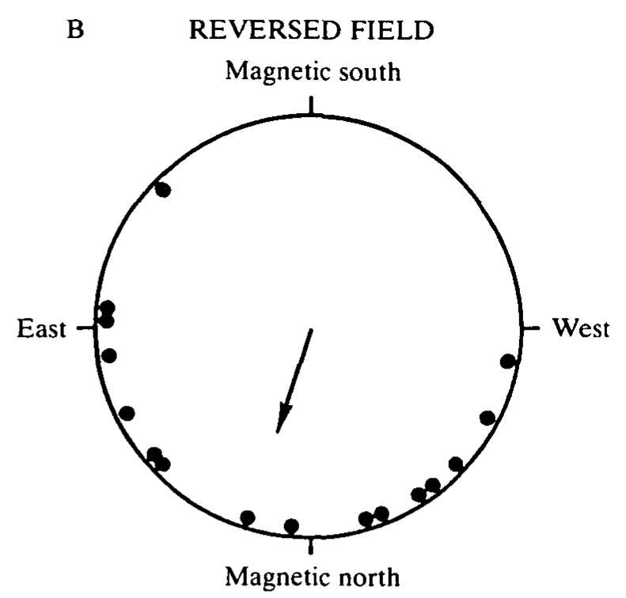
Field reversal changes the preferred swimming course
The coil reversed the horizontal magnetic component while leaving the vertical component unchanged. The imposed field opposed the natural horizontal field, so magnetic north shifted by 180°. The reversed horizontal field ranged from 0.23 to 0.26 Oe within the swimming zone; the natural horizontal field was 0.26 Oe.
Both groups received the same initial eastern light and were subsequently tested in darkness. Preferred headings changed from 42° in the natural field to 196° after reversal, a reported shift of 154°. Orientation under reversal was more dispersed, so the behavioral response was not a perfectly rigid copy of the imposed rotation.
These controls weaken an explanation based solely on a fixed room direction. The experiment demonstrates sensitivity to the manipulated field geometry. The horizontal reversal shifts magnetic north by 180°, and experiments that vary inclination test whether the compass depends on the polarity of the field or on the slope of the field lines.
Lohmann (1991), Fig. 2(B). Orientation under reversal of the horizontal field component.
Lohmann (1991)
04
Notes:
• The coil reversed the horizontal magnetic component while leaving the vertical component unchanged. The imposed field opposed the natural horizontal field, so magnetic north shifted by 180°. The reversed horizontal field ranged from 0.23 to 0.26 Oe within the swimming zone; the natural horizontal field was 0.26 Oe.
– Oersted is the magnetic field unit retained in this historical paper. Keep the reported units attached to their original measurements; the experiment compared controlled field configurations rather than testing responses to a modern everyday magnetic compass.
• Both groups received the same initial eastern light and were subsequently tested in darkness. Preferred headings changed from 42° in the natural field to 196° after reversal, a reported shift of 154°. Orientation under reversal was more dispersed, so the behavioral response was not a perfectly rigid copy of the imposed rotation.
• These controls weaken an explanation based solely on a fixed room direction. The experiment demonstrates sensitivity to the manipulated field geometry. The horizontal reversal shifts magnetic north by 180°, and experiments that vary inclination test whether the compass depends on the polarity of the field or on the slope of the field lines.
References:
Lohmann KJ (1991). Magnetic Orientation By Hatchling Loggerhead Sea Turtles (Caretta Caretta). Journal of Experimental Biology 155(1):37-49. https://doi.org/10.1242/jeb.155.1.37
Figure: Lohmann (1991), Fig. 2(B). Orientation under reversal of the horizontal field component.
Figure source: https://doi.org/10.1242/jeb.155.1.37

Slide 6
Polarity and inclination compasses use different information
A polarity compass distinguishes the two ends of a magnetic field line, so it knows which end points toward the magnetic pole. An inclination compass uses the angle at which field lines meet the horizontal and distinguishes poleward from equatorward by the slope of the line.
Reversing the horizontal component of the field changed the preferred swimming course of hatchlings from 42° to 196°. The coil shifted magnetic north by 180° while the vertical component stayed unchanged.
A reversal of the horizontal component alone does not separate the two kinds of compass. Experiments that change inclination while holding field strength constant test which property of the field the turtle uses.
Lohmann (1991), Fig. 2(B). Orientation under reversal of the horizontal field component.
Lohmann (1991)
04a
Notes:
• The same behavior can arise from two different compass designs.
• Polarity compass.
– A polarity compass distinguishes the two directed ends of a magnetic vector.
• Inclination compass.
– An inclination compass uses the axial slope of the field lines relative to the horizontal.
– Poleward is the direction in which the field lines dip more steeply.
• The manipulation.
– The coil reversed the horizontal component and left the vertical component unchanged.
– Magnetic north shifted by 180 degrees.
• Field values.
– The natural horizontal field was 0.26 oersted.
– The reversed field ranged from 0.23 to 0.26 oersted in the swimming zone.
• Result.
– The preferred heading shifted from 42 to 196 degrees.
– Orientation under reversal was more dispersed.
• Next test.
– Varying inclination at constant intensity separates the slope of the field from its polarity.
• Why this does not separate the designs.
– Reversing the horizontal component reverses polarity and also reverses the horizontal direction of the field axis.
– Both designs predict a change in heading.
References:
Lohmann KJ (1991). Magnetic Orientation By Hatchling Loggerhead Sea Turtles (Caretta Caretta). Journal of Experimental Biology 155(1):37-49. https://doi.org/10.1242/jeb.155.1.37

Slide 7
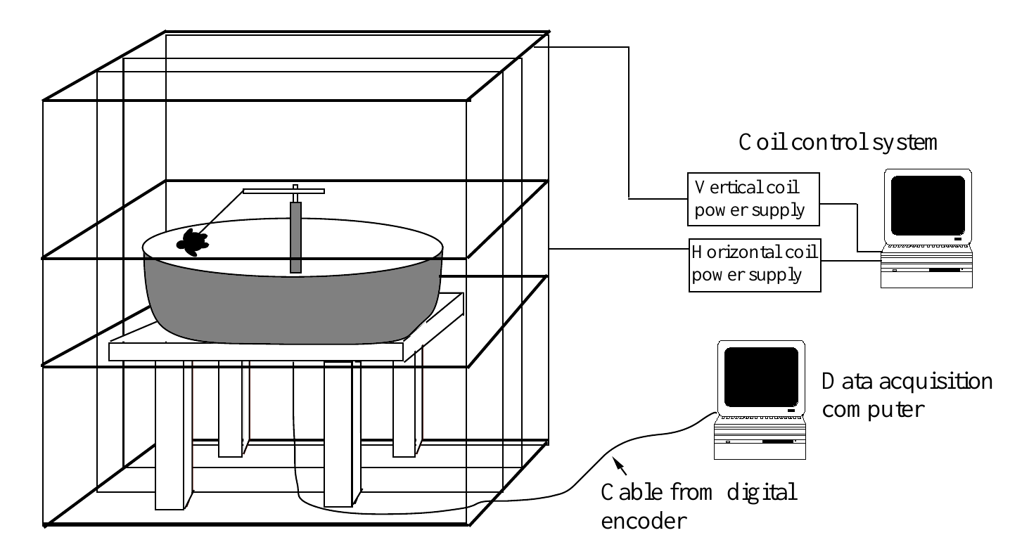
Independent field components isolate inclination
Magnetic inclination is the angle at which field lines intersect the horizontal surface. Lohmann and Lohmann varied inclination while keeping total field strength approximately constant. Their preparation therefore separated the directional slope of the field from intensity, the magnitude of the magnetic field.
Two orthogonal coil systems controlled the horizontal and vertical components independently. Hatchlings swam in a 1.22-m arena, and a digital encoder recorded heading to the nearest 1.4° every 10 s. The measured total field strength was 0.044–0.045 mT across the experimental conditions.
Computers and power supplies remained active in every treatment and were located in an adjacent room. Similar sounds and vibrations were therefore present regardless of inclination. A change in behavior under these conditions can be attributed more specifically to field geometry than to equipment switching or a correlated change in field magnitude.
Lohmann & Lohmann (1994), Fig. 1. Independent horizontal and vertical coils control inclination.
Lohmann & Lohmann (1994)
05
Notes:
• Magnetic inclination is the angle at which field lines intersect the horizontal surface. Lohmann and Lohmann varied inclination while keeping total field strength approximately constant. Their preparation therefore separated the directional slope of the field from intensity, the magnitude of the magnetic field.
– The total field is composed of horizontal and vertical components. Changing their relative contribution changes inclination, whereas the controlled overall magnitude prevents intensity from supplying the explanation for the treatment difference.
• Two orthogonal coil systems controlled the horizontal and vertical components independently. Hatchlings swam in a 1.22-m arena, and a digital encoder recorded heading to the nearest 1.4° every 10 s. The measured total field strength was 0.044–0.045 mT across the experimental conditions.
• Computers and power supplies remained active in every treatment and were located in an adjacent room. Similar sounds and vibrations were therefore present regardless of inclination. A change in behavior under these conditions can be attributed more specifically to field geometry than to equipment switching or a correlated change in field magnitude.
References:
Lohmann KJ, Lohmann CMF (1994). Detection of Magnetic Inclination Angle by Sea Turtles: A Possible Mechanism for Determining Latitude. Journal of Experimental Biology 194(1):23-32. https://doi.org/10.1242/jeb.194.1.23
Figure: Lohmann & Lohmann (1994), Fig. 1. Independent horizontal and vertical coils control inclination.
Figure source: https://doi.org/10.1242/jeb.194.1.23

Slide 8
Inclination and intensity are separate field properties
Intensity is the magnitude of the magnetic field, and inclination is the angle of the field lines relative to the horizontal. Earth's field varies in both properties with location, but the two can be changed independently in the laboratory. Holding intensity constant isolates the effect of the slope of the field.
Lohmann and Lohmann used two orthogonal coil systems to control the horizontal and vertical components. Total field strength stayed at 0.044 to 0.045 mT across conditions while inclination changed.
Computers and power supplies remained active in every treatment and were located in an adjacent room. Any change in behavior can therefore be attributed to the geometry of the field and not to equipment noise or a change in strength.
Lohmann & Lohmann (1994), Fig. 1. Independent horizontal and vertical coils control inclination.
Lohmann & Lohmann (1994)
05a
Notes:
• Separating two properties of the field allows each to be tested alone.
• Definitions.
– Intensity is the magnitude of the field.
– Inclination is the angle at which field lines intersect the horizontal.
• Natural covariation.
– In nature both properties change with location.
– In the laboratory they can be set separately.
• Coils.
– Two orthogonal coil systems controlled the horizontal and vertical components independently.
• Arena.
– Hatchlings swam in a 1.22-meter arena.
– A digital encoder recorded heading to the nearest 1.4 degrees every 10 seconds.
• Constant strength.
– Total field strength was 0.044 to 0.045 millitesla across conditions.
• Equipment controls.
– Computers and power supplies stayed active in every treatment and sat in an adjacent room.
• Why intensity must be constant.
– A change in field strength could itself affect behavior.
– Holding strength near 0.045 millitesla removes that possibility.
• Interpretation.
– A change in heading across inclinations therefore reflects the angle of the field lines.
– The measured total field strength stayed within a narrow range in every condition.
References:
Lohmann KJ, Lohmann CMF (1994). Detection of Magnetic Inclination Angle by Sea Turtles: A Possible Mechanism for Determining Latitude. Journal of Experimental Biology 194(1):23-32. https://doi.org/10.1242/jeb.194.1.23

Slide 9
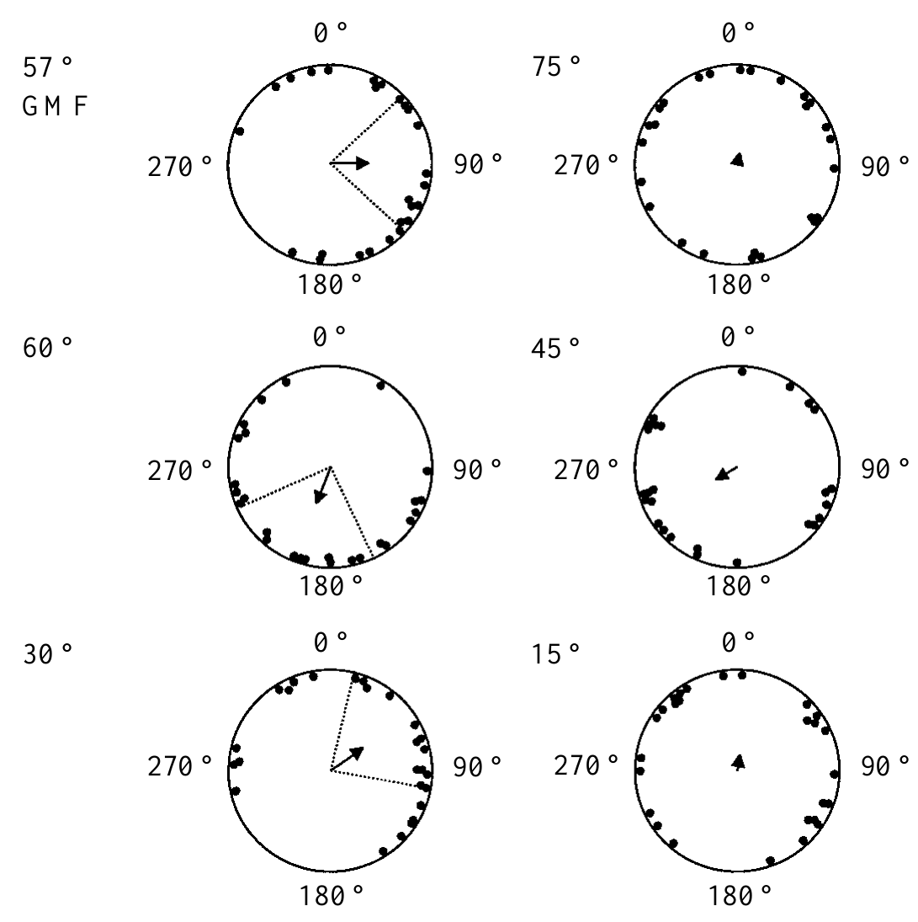
Inclination changes evoke different turtle headings
Hatchlings first swam toward an eastern light for 10 min. After the light was extinguished, investigators changed inclination, allowed 3 min for adjustment, and recorded swimming for 5 min in darkness. Each animal experienced only one inclination treatment, avoiding repeated exposure to an unfamiliar sequence of fields.
At the local inclination of 57°, turtles preferred 90°, approximately east. At 60°, they preferred 200°, south-southwest. At 30°, their preferred heading was 57°, northeast. Fields inclined at 75°, 45° or 15° did not produce a consistent group direction under the same test procedure.
The contrast between 57° and 60° establishes discrimination between nearby inclination conditions while field strength remains constant. The different headings at 57°, 60° and 30° show that hatchlings respond to the angle of the field lines, and some inclinations produced no consistent group direction under the same procedure.
Lohmann & Lohmann (1994), Fig. 2. Swimming responses to six field inclination angles.
Lohmann & Lohmann (1994)
06
Notes:
• Hatchlings first swam toward an eastern light for 10 min. After the light was extinguished, investigators changed inclination, allowed 3 min for adjustment, and recorded swimming for 5 min in darkness. Each animal experienced only one inclination treatment, avoiding repeated exposure to an unfamiliar sequence of fields.
– The experiment distinguishes sensory detection from the expression of an oriented motor response. A detectable field can fail to trigger a shared heading, especially when it lacks the ecological meaning of a field encountered near a route boundary.
• At the local inclination of 57°, turtles preferred 90°, approximately east. At 60°, they preferred 200°, south-southwest. At 30°, their preferred heading was 57°, northeast. Fields inclined at 75°, 45° or 15° did not produce a consistent group direction under the same test procedure.
• The contrast between 57° and 60° establishes discrimination between nearby inclination conditions while field strength remains constant. The different headings at 57°, 60° and 30° show that hatchlings respond to the angle of the field lines, and some inclinations produced no consistent group direction under the same procedure.
References:
Lohmann KJ, Lohmann CMF (1994). Detection of Magnetic Inclination Angle by Sea Turtles: A Possible Mechanism for Determining Latitude. Journal of Experimental Biology 194(1):23-32. https://doi.org/10.1242/jeb.194.1.23
Figure: Lohmann & Lohmann (1994), Fig. 2. Swimming responses to six field inclination angles.
Figure source: https://doi.org/10.1242/jeb.194.1.23

Slide 10
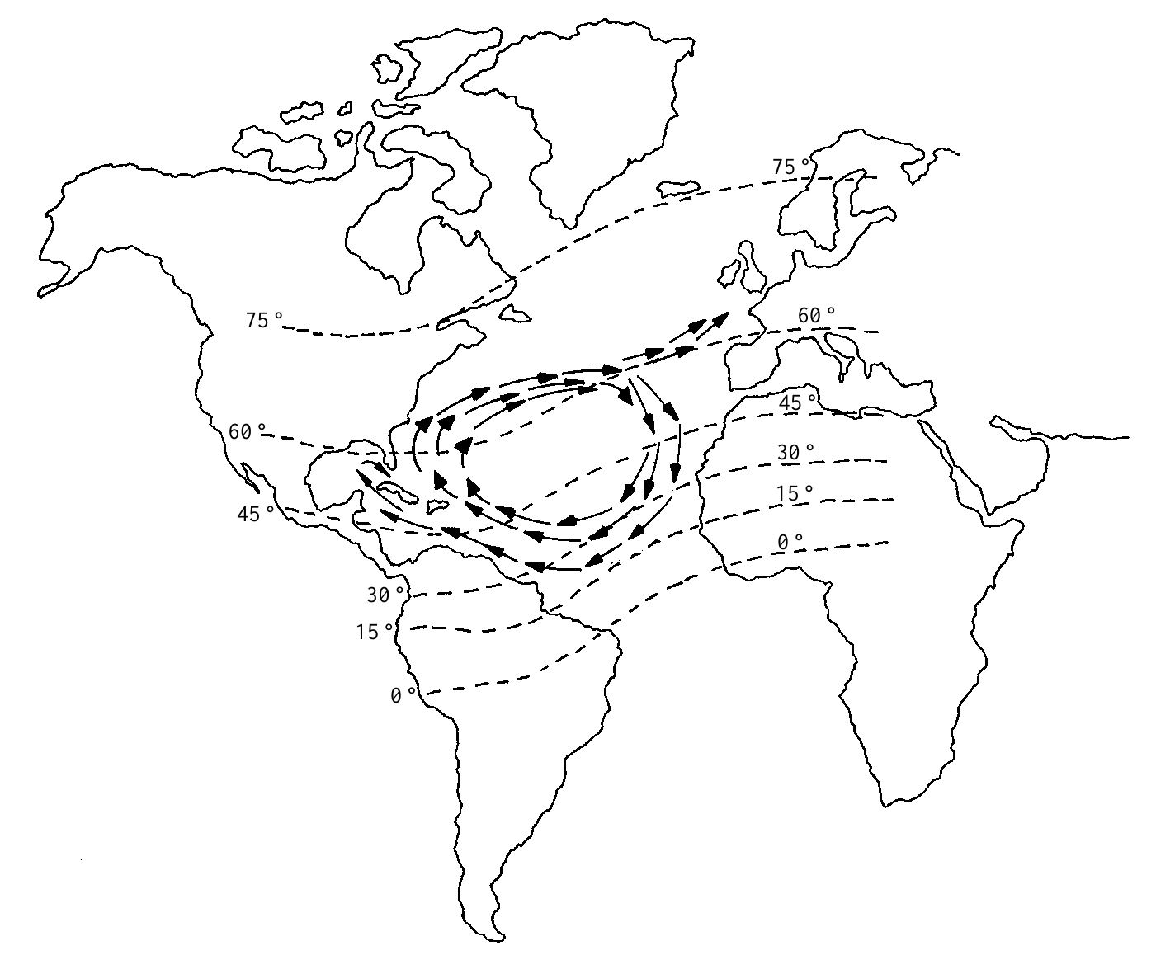
Magnetic slope can mark dangerous gyre boundaries
An isoclinic is a line connecting locations with the same magnetic inclination. The published North Atlantic map places inclination values alongside currents followed by young loggerheads. The northern gyre boundary approaches the region where the Gulf Stream divides and colder water lies farther north.
Turtles exposed to 60° inclination swam south-southwest, whereas those exposed to 30° swam northeast. These directions are consistent with movements away from the northern and southern extremes of the gyre. The controlled experiment established inclination-dependent behavior; the geographical interpretation connects that behavior to plausible survival consequences.
The authors proposed that inclination could contribute to approximate latitude detection and recognition of nesting regions. Inclination varies with latitude, so the angle of the field lines could mark approximate position along the migratory route.
Lohmann & Lohmann (1994), Fig. 3. Published gyre currents and magnetic inclination isolines.
Lohmann & Lohmann (1994)
07
Notes:
• An isoclinic is a line connecting locations with the same magnetic inclination. The published North Atlantic map places inclination values alongside currents followed by young loggerheads. The northern gyre boundary approaches the region where the Gulf Stream divides and colder water lies farther north.
– A latitude-related signal is not automatically a unique address. The same inclination can occur at multiple locations, so positional use requires an appropriate geographical range, additional magnetic parameters or information from other sensory systems.
• Turtles exposed to 60° inclination swam south-southwest, whereas those exposed to 30° swam northeast. These directions are consistent with movements away from the northern and southern extremes of the gyre. The controlled experiment established inclination-dependent behavior; the geographical interpretation connects that behavior to plausible survival consequences.
• The authors proposed that inclination could contribute to approximate latitude detection and recognition of nesting regions. Inclination varies with latitude, so the angle of the field lines could mark approximate position along the migratory route.
References:
Lohmann KJ, Lohmann CMF (1994). Detection of Magnetic Inclination Angle by Sea Turtles: A Possible Mechanism for Determining Latitude. Journal of Experimental Biology 194(1):23-32. https://doi.org/10.1242/jeb.194.1.23
Figure: Lohmann & Lohmann (1994), Fig. 3. Published gyre currents and magnetic inclination isolines.
Figure source: https://doi.org/10.1242/jeb.194.1.23

Slide 11
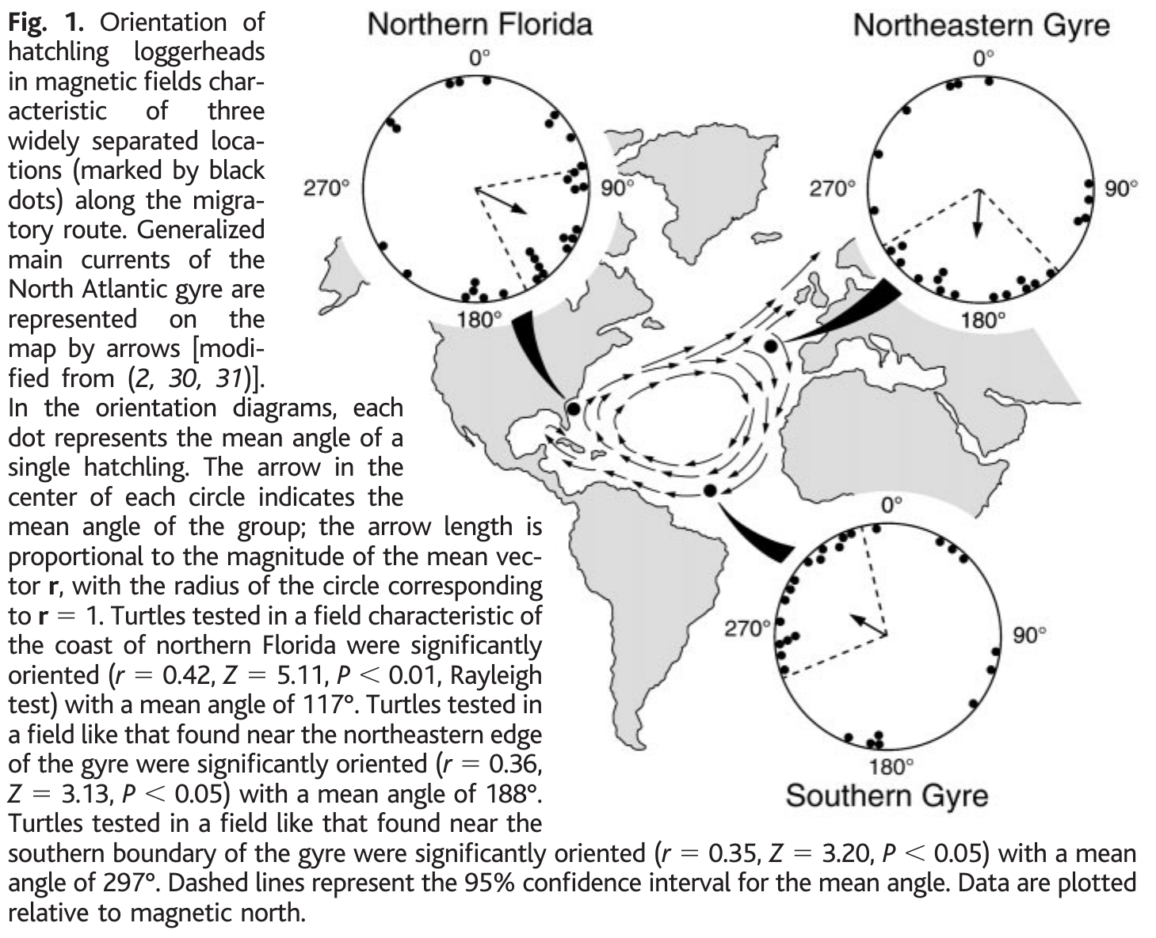
Regional magnetic signatures trigger route changes
A magnetic signature is the combination of magnetic parameters characteristic of a location. Lohmann and colleagues replicated three fields from the North Atlantic migratory route. Unlike experiments that changed inclination alone, these treatments used combinations of inclination and intensity that naturally occur in widely separated oceanic regions.
Hatchlings tethered inside a computerized coil system oriented east-southeast in the northern Florida field, approximately south in the northeastern gyre field, and west-northwest in the southern gyre field. The tracking apparatus recorded heading while the animals remained physically in the same laboratory arena.
The field-dependent changes are consistent with entering favorable currents and avoiding displacement beyond the gyre. They establish recognition of regional magnetic conditions with different motor responses. Hatchlings therefore respond to combinations of inclination and intensity that mark regions of the route, with a different heading for each regional field.
Lohmann et al. (2001), Fig. 1. Three regional fields evoke different hatchling headings.
Lohmann et al. (2001)
08
Notes:
• A magnetic signature is the combination of magnetic parameters characteristic of a location. Lohmann and colleagues replicated three fields from the North Atlantic migratory route. Unlike experiments that changed inclination alone, these treatments used combinations of inclination and intensity that naturally occur in widely separated oceanic regions.
– The experimental variable was the regional magnetic field rather than physical travel. The hatchlings did not encounter different water masses, coastlines or currents during testing, so those cues cannot account for the between-treatment headings.
• Hatchlings tethered inside a computerized coil system oriented east-southeast in the northern Florida field, approximately south in the northeastern gyre field, and west-northwest in the southern gyre field. The tracking apparatus recorded heading while the animals remained physically in the same laboratory arena.
• The field-dependent changes are consistent with entering favorable currents and avoiding displacement beyond the gyre. They establish recognition of regional magnetic conditions with different motor responses. Hatchlings therefore respond to combinations of inclination and intensity that mark regions of the route, with a different heading for each regional field.
References:
Lohmann KJ, Cain SD, Dodge SA, Lohmann CMF (2001). Regional Magnetic Fields as Navigational Markers for Sea Turtles. Science 294(5541):364-366. https://doi.org/10.1126/science.1064557
Figure: Lohmann et al. (2001), Fig. 1. Three regional fields evoke different hatchling headings.
Figure source: https://doi.org/10.1126/science.1064557

Slide 12
A magnetic signature combines inclination and intensity
A magnetic signature is the combination of magnetic parameters that characterizes a location. Inclination and intensity vary together across the ocean, so a particular pair of values marks a particular region. The signature of a region is therefore a property of the field at that place.
Lohmann and colleagues replicated three fields from the North Atlantic route of loggerheads and tethered hatchlings in a coil system. Hatchlings oriented east-southeast in the northern Florida field, south in the northeastern gyre field and west-northwest in the southern gyre field.
The animals stayed in the same laboratory arena while the field changed. Each regional signature therefore triggered a different heading, which is consistent with moving toward favorable currents and away from the edges of the gyre.
Lohmann et al. (2001), Fig. 1. Three regional fields evoke different hatchling headings.
Lohmann et al. (2001)
08a
Notes:
• A location can be recognized from several field properties at once.
• Definition.
– A magnetic signature is the combination of magnetic parameters characteristic of a location.
• Why a combination.
– Inclination and intensity vary together across the ocean.
– A pair of values is more specific than either value alone.
• Fields tested.
– Three fields from the North Atlantic route were replicated.
• Responses.
– East-southeast in the northern Florida field.
– South in the northeastern gyre field and west-northwest in the southern gyre field.
• Apparatus.
– A computerized coil system set the field while the animals stayed in the same arena.
• Interpretation.
– The headings fit movement into favorable currents and away from displacement beyond the gyre.
• Hatchlings had not been to sea.
– The tested hatchlings had never entered the ocean, so the responses did not depend on prior travel in those regions.
• Routes.
– The route is the North Atlantic gyre followed by young loggerheads.
– The fields come from locations along that route.
References:
Lohmann KJ, Cain SD, Dodge SA, Lohmann CMF (2001). Regional Magnetic Fields as Navigational Markers for Sea Turtles. Science 294(5541):364-366. https://doi.org/10.1126/science.1064557

Slide 13
Early route responses need not require prior travel
The hatchlings in the regional-field experiment had never entered the ocean. Their different headings therefore did not require previous experience of the tested oceanic regions. A directional response could be expressed upon first exposure to a magnetic signature encountered naturally near a critical route boundary.
An inherited large-scale map is one possible interpretation. A simpler alternative is a set of field-triggered instructions: swim south under one signature and west-northwest under another. Both accounts predict appropriate local heading changes, but only the first requires a more general representation of geographical position.
The laboratory responses distinguish regional fields without deciding between an inherited map and field-triggered instructions. More sophisticated navigation could develop as turtles mature, and experience-dependent magnetic learning can coexist with early boundary responses.
Lohmann et al. (2001), Fig. 1. Regional orientation responses along the North Atlantic gyre.
Lohmann et al. (2001)
09
Notes:
• The hatchlings in the regional-field experiment had never entered the ocean. Their different headings therefore did not require previous experience of the tested oceanic regions. A directional response could be expressed upon first exposure to a magnetic signature encountered naturally near a critical route boundary.
– A map sense determines something about position, whereas a compass sets a heading. The regional-field assay requires a location-dependent change in compass direction, but it does not reveal how the brain represents the field or chooses the resulting action.
• An inherited large-scale map is one possible interpretation. A simpler alternative is a set of field-triggered instructions: swim south under one signature and west-northwest under another. Both accounts predict appropriate local heading changes, but only the first requires a more general representation of geographical position.
• The laboratory responses distinguish regional fields without deciding between an inherited map and field-triggered instructions. More sophisticated navigation could develop as turtles mature, and experience-dependent magnetic learning can coexist with early boundary responses.
References:
Lohmann KJ, Cain SD, Dodge SA, Lohmann CMF (2001). Regional Magnetic Fields as Navigational Markers for Sea Turtles. Science 294(5541):364-366. https://doi.org/10.1126/science.1064557
Figure: Lohmann et al. (2001), Fig. 1. Regional orientation responses along the North Atlantic gyre.
Figure source: https://doi.org/10.1126/science.1064557

Slide 14
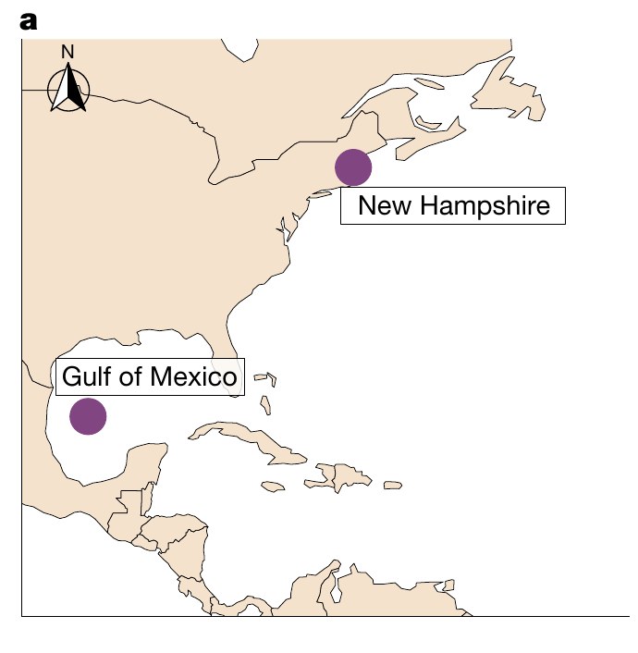
Juvenile turtles learn rewarded magnetic signatures
Associative learning links a sensory cue with an outcome. Goforth and colleagues conditioned captive juvenile loggerheads for 2 months using two replicated geographical fields. Animals spent equal amounts of time in the fields, but food was delivered only in one assigned magnetic signature.
The first pairing represented the Gulf of Mexico and New Hampshire. Reward assignments were counterbalanced: either field could predict food. This control separates recognition of a particular magnetic signature from a universal preference for a northern field, southern field or fixed condition of the coil apparatus.
After conditioning, turtles were tested without food. Their responses were stronger in the field previously paired with feeding. Magnetic information therefore acquired learned behavioral significance. The learned response shows that magnetic signatures can serve as cues that predict food.
Goforth et al. (2025), Fig. 1(a). Locations of the two conditioned magnetic signatures.
Goforth et al. (2025)
10
Notes:
• Associative learning links a sensory cue with an outcome. Goforth and colleagues conditioned captive juvenile loggerheads for 2 months using two replicated geographical fields. Animals spent equal amounts of time in the fields, but food was delivered only in one assigned magnetic signature.
– Counterbalancing means that the relationship between a field and its reward differs between animals. A field that predicts food for one turtle predicts no food for another, allowing the learned association to be separated from an intrinsic response to that field.
• The first pairing represented the Gulf of Mexico and New Hampshire. Reward assignments were counterbalanced: either field could predict food. This control separates recognition of a particular magnetic signature from a universal preference for a northern field, southern field or fixed condition of the coil apparatus.
• After conditioning, turtles were tested without food. Their responses were stronger in the field previously paired with feeding. Magnetic information therefore acquired learned behavioral significance. The learned response shows that magnetic signatures can serve as cues that predict food.
References:
Goforth KM, Lohmann CMF, Gavin A, Henning R, Harvey A, Hinton TL, Lim DS, Lohmann KJ (2025). Learned magnetic map cues and two mechanisms of magnetoreception in turtles. Nature 638(8052):1015-1022. https://doi.org/10.1038/s41586-024-08554-y
Figure: Goforth et al. (2025), Fig. 1(a). Locations of the two conditioned magnetic signatures.
Figure source: https://doi.org/10.1038/s41586-024-08554-y

Slide 15
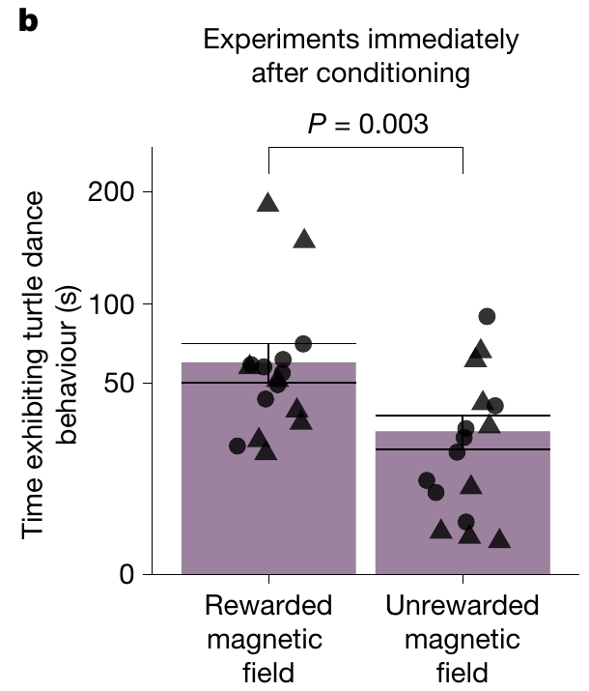
Food anticipation provides a compass-free map assay
The conditioned response was turtle dancing, a food-anticipatory pattern involving vertical body tilt, the head near or above water, mouth opening and alternating front-flipper movement. Investigators scored the duration of this behavior from video recordings while turtles experienced a magnetic field without receiving food.
Observers were blind to magnetic treatment. Turtles danced more in the rewarded signature than in the unrewarded signature after equivalent exposure to both during training. The measured output was time spent in a defined behavioral state rather than the direction of swimming toward a remembered destination.
This assay tests discrimination of location-related magnetic cues without requiring a magnetic compass heading. That separation permits selective tests of a map mechanism. Turtle dancing is a behavioral readout of the learned significance of the field, and it can be scored from video by observers who do not know the treatment.
Goforth et al. (2025), Fig. 1(b). Rewarded fields elicit stronger food-anticipatory behavior.
Goforth et al. (2025)
11
Notes:
• The conditioned response was turtle dancing, a food-anticipatory pattern involving vertical body tilt, the head near or above water, mouth opening and alternating front-flipper movement. Investigators scored the duration of this behavior from video recordings while turtles experienced a magnetic field without receiving food.
– Blind scoring reduces the chance that knowledge of the field influences behavioral classification. Testing without food also prevents the animal from using food odor or the immediate presence of a feeding reward to distinguish the two fields.
• Observers were blind to magnetic treatment. Turtles danced more in the rewarded signature than in the unrewarded signature after equivalent exposure to both during training. The measured output was time spent in a defined behavioral state rather than the direction of swimming toward a remembered destination.
• This assay tests discrimination of location-related magnetic cues without requiring a magnetic compass heading. That separation permits selective tests of a map mechanism. Turtle dancing is a behavioral readout of the learned significance of the field, and it can be scored from video by observers who do not know the treatment.
References:
Goforth KM, Lohmann CMF, Gavin A, Henning R, Harvey A, Hinton TL, Lim DS, Lohmann KJ (2025). Learned magnetic map cues and two mechanisms of magnetoreception in turtles. Nature 638(8052):1015-1022. https://doi.org/10.1038/s41586-024-08554-y
Figure: Goforth et al. (2025), Fig. 1(b). Rewarded fields elicit stronger food-anticipatory behavior.
Figure source: https://doi.org/10.1038/s41586-024-08554-y

Slide 16
Associative learning links a cue to an outcome
Associative learning is the formation of a link between a sensory cue and an outcome. After a cue has reliably predicted food, the animal shows anticipatory behavior when the cue appears. The behavior is measured in the absence of food, so it reflects memory of the association.
Goforth and colleagues conditioned juvenile loggerheads for 2 months with two replicated geographical fields. Animals spent equal time in the fields, and food was delivered only in one assigned signature, with the rewarded field counterbalanced across animals.
After conditioning, turtles were tested without food and danced more in the rewarded field. Counterbalancing shows that the response follows the association and not a preference for a northern field, a southern field or part of the apparatus. Dancing therefore reports recognition of a magnetic signature.
Goforth et al. (2025), Fig. 1(b). Rewarded fields elicit stronger food-anticipatory behavior.
Goforth et al. (2025)
11a
Notes:
• Learning gives magnetic fields a meaning that the experimenter assigns.
• Definition.
– Associative learning links a sensory cue with an outcome.
• Conditioning.
– Juvenile loggerheads were conditioned for 2 months with two replicated geographical fields.
– Time spent in the two fields was equal.
• Reward.
– Food was delivered only in one assigned signature.
• Counterbalancing.
– Either field could predict food across animals.
– This separates a learned association from a fixed preference.
• Test.
– Turtles were tested without food.
– Turtle dancing was scored from video.
• Result.
– Dancing was longer in the field that had been paired with food.
• Behavior scored.
– Turtle dancing includes vertical body tilt, the head near or above water, mouth opening and alternating front-flipper movement.
– Duration was scored from video recordings.
• Blind scoring.
– Observers did not know the magnetic treatment.
– Turtles danced more in the rewarded signature after equivalent exposure to both.
– The output is time spent in a behavioral state and not the direction of swimming.
References:
Goforth KM, Lohmann CMF, Gavin A, Henning R, Harvey A, Hinton TL, Lim DS, Lohmann KJ (2025). Learned magnetic map cues and two mechanisms of magnetoreception in turtles. Nature 638(8052):1015-1022. https://doi.org/10.1038/s41586-024-08554-y

Slide 17
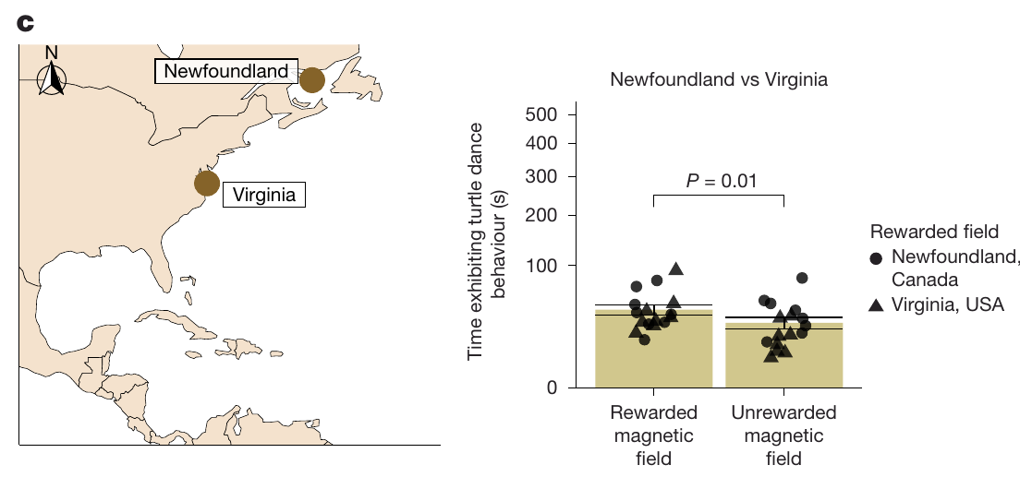
Magnetic learning extends beyond one pair of fields
Additional cohorts learned pairs representing Cuba and Delaware, Florida and Maine, and locations elsewhere in the western Atlantic. These pairings differed in geographical and magnetic separation. Recognition therefore was not restricted to the first Gulf of Mexico–New Hampshire contrast used to establish the assay.
Turtles first conditioned with the Florida–Maine pair were subsequently conditioned with a second pair representing a second set of magnetic signatures. They also discriminated the rewarded and unrewarded signatures in that second pairing. The same animals could acquire an additional association after the first training period.
The result supports flexibility in magnetic learning rather than a single fixed regional response. Recognition extended across pairs that differed in geographical and magnetic separation, and a second pair was learned after the first.
Goforth et al. (2025), Fig. 2(c). A second pair of fields can acquire a learned association.
Goforth et al. (2025)
12
Notes:
• Additional cohorts learned pairs representing Cuba and Delaware, Florida and Maine, and locations elsewhere in the western Atlantic. These pairings differed in geographical and magnetic separation. Recognition therefore was not restricted to the first Gulf of Mexico–New Hampshire contrast used to establish the assay.
– The evidence concerns acquisition under controlled reinforcement. A laboratory capacity to learn multiple signatures is compatible with natural return to different feeding areas, but the behavioral experiment does not directly document such a journey.
• Turtles first conditioned with the Florida–Maine pair were subsequently conditioned with a second pair representing a second set of magnetic signatures. They also discriminated the rewarded and unrewarded signatures in that second pairing. The same animals could acquire an additional association after the first training period.
• The result supports flexibility in magnetic learning rather than a single fixed regional response. Recognition extended across pairs that differed in geographical and magnetic separation, and a second pair was learned after the first.
References:
Goforth KM, Lohmann CMF, Gavin A, Henning R, Harvey A, Hinton TL, Lim DS, Lohmann KJ (2025). Learned magnetic map cues and two mechanisms of magnetoreception in turtles. Nature 638(8052):1015-1022. https://doi.org/10.1038/s41586-024-08554-y
Figure: Goforth et al. (2025), Fig. 2(c). A second pair of fields can acquire a learned association.
Figure source: https://doi.org/10.1038/s41586-024-08554-y

Slide 18
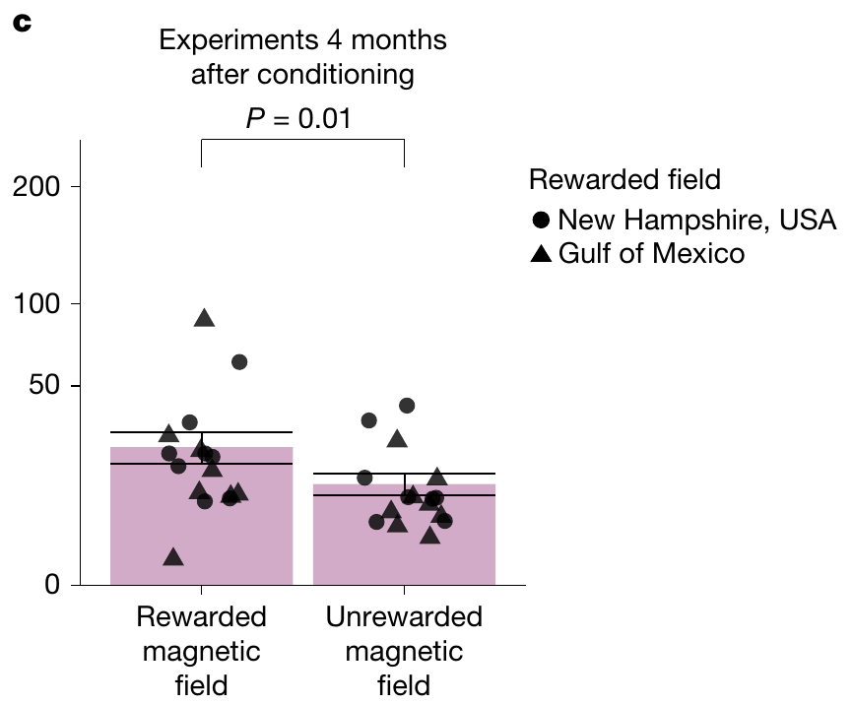
A learned magnetic association persists for months
The Gulf of Mexico–New Hampshire cohort was tested again 4 months after initial conditioning. No conditioning to those two fields occurred during the intervening period. The follow-up therefore assessed persistence of the association rather than immediate responses after another reinforced training session.
Turtles continued to express more food-anticipatory behavior in their originally rewarded field. Magnetic signature information can remain behaviorally available for several months. Retention was assessed through the same compass-free discrimination task used after the initial 2-month conditioning period.
The result establishes that a learned magnetic association can persist for at least four months in captivity. Retention was measured with the same compass-free discrimination task, without further conditioning during the interval.
Goforth et al. (2025), Fig. 1(c). Field discrimination persists four months after conditioning.
Goforth et al. (2025)
13
Notes:
• The Gulf of Mexico–New Hampshire cohort was tested again 4 months after initial conditioning. No conditioning to those two fields occurred during the intervening period. The follow-up therefore assessed persistence of the association rather than immediate responses after another reinforced training session.
– The learned response can persist without immediate reinforcement, but its expression still depends on the animal’s motivational and behavioral state. The experiment measures an available association through food anticipation, not an isolated physical trace of memory in neural tissue.
• Turtles continued to express more food-anticipatory behavior in their originally rewarded field. Magnetic signature information can remain behaviorally available for several months. Retention was assessed through the same compass-free discrimination task used after the initial 2-month conditioning period.
• The result establishes that a learned magnetic association can persist for at least four months in captivity. Retention was measured with the same compass-free discrimination task, without further conditioning during the interval.
References:
Goforth KM, Lohmann CMF, Gavin A, Henning R, Harvey A, Hinton TL, Lim DS, Lohmann KJ (2025). Learned magnetic map cues and two mechanisms of magnetoreception in turtles. Nature 638(8052):1015-1022. https://doi.org/10.1038/s41586-024-08554-y
Figure: Goforth et al. (2025), Fig. 1(c). Field discrimination persists four months after conditioning.
Figure source: https://doi.org/10.1038/s41586-024-08554-y

Slide 19
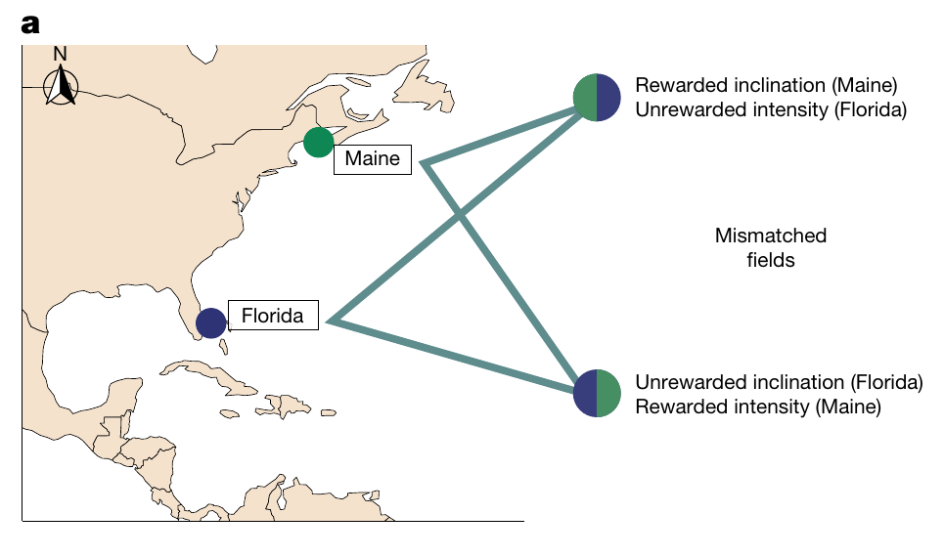
Cue mixing tests what defines a learned signature
Inclination and intensity varied together during conditioning. To determine whether either parameter alone could explain recognition, Goforth and colleagues constructed mismatched fields that combined the inclination of one learned field with the intensity of the other. These combinations separated features that normally occurred as a pair.
Turtles were tested in the rewarded field, the unrewarded field and the two mismatched combinations. The manipulation retained one rewarded component while changing the other. It therefore tested whether a familiar inclination or a familiar intensity was sufficient to evoke the learned food-anticipatory response.
A signature can function as a compound cue rather than a single coordinate. This experimental design addresses the information used for discrimination, without requiring assumptions about a complete geographical map. Mismatched fields separate the contribution of inclination from that of intensity, so the compound cue can be analyzed into its components.
Goforth et al. (2025), Fig. 4(a). Published inclination–intensity combinations used in cue mixing.
Goforth et al. (2025)
14
Notes:
• Inclination and intensity varied together during conditioning. To determine whether either parameter alone could explain recognition, Goforth and colleagues constructed mismatched fields that combined the inclination of one learned field with the intensity of the other. These combinations separated features that normally occurred as a pair.
– The mismatched combinations were designed from the trained fields rather than from an animal’s physical displacement. Their purpose was to isolate the contribution of each magnetic parameter to recognition of the rewarded condition.
• Turtles were tested in the rewarded field, the unrewarded field and the two mismatched combinations. The manipulation retained one rewarded component while changing the other. It therefore tested whether a familiar inclination or a familiar intensity was sufficient to evoke the learned food-anticipatory response.
• A signature can function as a compound cue rather than a single coordinate. This experimental design addresses the information used for discrimination, without requiring assumptions about a complete geographical map. Mismatched fields separate the contribution of inclination from that of intensity, so the compound cue can be analyzed into its components.
References:
Goforth KM, Lohmann CMF, Gavin A, Henning R, Harvey A, Hinton TL, Lim DS, Lohmann KJ (2025). Learned magnetic map cues and two mechanisms of magnetoreception in turtles. Nature 638(8052):1015-1022. https://doi.org/10.1038/s41586-024-08554-y
Figure: Goforth et al. (2025), Fig. 4(a). Published inclination–intensity combinations used in cue mixing.
Figure source: https://doi.org/10.1038/s41586-024-08554-y

Slide 20
Mismatched fields test which components matter
Mismatched fields combine the inclination of one learned field with the intensity of the other. Because inclination and intensity normally occur as a pair, the mismatched combinations separate features that were always presented together during training. Mismatched fields were new to the turtles and were not paired with food during training.
Goforth and colleagues tested turtles in the rewarded field, the unrewarded field and the two mismatched combinations. Each mismatched field kept one rewarded component and changed the other. Responses in each condition were scored from the same behavioral measure.
The test asks whether a familiar inclination or a familiar intensity is enough to evoke the learned response. If neither is enough, the learned signature is a compound cue that depends on the combination.
Goforth et al. (2025), Fig. 4(a). Published inclination–intensity combinations used in cue mixing.
Goforth et al. (2025)
14a
Notes:
• A mismatch separates two features that normally occur together.
• Training fields.
– Inclination and intensity varied together during conditioning.
• Mismatched fields.
– One mismatched field combined the inclination of one learned field with the intensity of the other.
– The second mismatched field reversed this pairing.
• Test conditions.
– Turtles were tested in the rewarded field, the unrewarded field and both mismatched fields.
• Question.
– The test asks whether a familiar inclination or a familiar intensity alone is sufficient.
• Possible outcomes.
– A response to a mismatched field would show that one component is sufficient.
– No response would show that the combination is needed.
• Compound cue.
– A signature can function as a compound cue and not as a single coordinate.
• Possible readouts.
– If turtles danced in a mismatched field, one component would be sufficient.
– If they did not dance, both components would be needed.
• Compound signature.
– A signature can act as a compound cue, which is not a single coordinate.
References:
Goforth KM, Lohmann CMF, Gavin A, Henning R, Harvey A, Hinton TL, Lim DS, Lohmann KJ (2025). Learned magnetic map cues and two mechanisms of magnetoreception in turtles. Nature 638(8052):1015-1022. https://doi.org/10.1038/s41586-024-08554-y

Slide 21
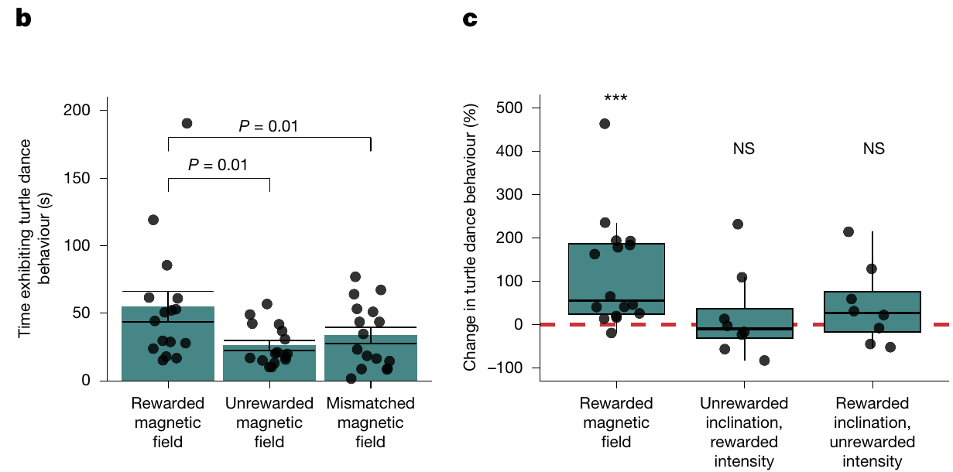
Recognition requires the trained cue combination
Turtles responded more strongly to the rewarded signature than to either mismatched combination. Neither the rewarded inclination paired with the wrong intensity nor the rewarded intensity paired with the wrong inclination produced the response expected from the complete trained field.
The mismatch responses resembled those to the unrewarded field. The result supports joint use of inclination and intensity in this task. It does not mean that animals cannot detect either parameter individually; it means that one familiar component was insufficient to identify the rewarded compound under the tested conditions.
The distinction separates sensory discrimination from learned decision rules. An animal may detect several field properties but respond only when their combination matches a stored association. The comparison with a stored association could occur in transduction, sensory pathways, memory circuits or the selection of a food-anticipatory action.
Goforth et al. (2025), Fig. 4(b–c). Mismatched field components do not evoke the rewarded response.
Goforth et al. (2025)
15
Notes:
• Turtles responded more strongly to the rewarded signature than to either mismatched combination. Neither the rewarded inclination paired with the wrong intensity nor the rewarded intensity paired with the wrong inclination produced the response expected from the complete trained field.
– The response criterion is learned recognition. The field measurements define the physical stimuli, while behavioral duration reports whether a stimulus has acquired reward-related meaning; neither measurement records the intermediate neural computation.
• The mismatch responses resembled those to the unrewarded field. The result supports joint use of inclination and intensity in this task. It does not mean that animals cannot detect either parameter individually; it means that one familiar component was insufficient to identify the rewarded compound under the tested conditions.
• The distinction separates sensory discrimination from learned decision rules. An animal may detect several field properties but respond only when their combination matches a stored association. The comparison with a stored association could occur in transduction, sensory pathways, memory circuits or the selection of a food-anticipatory action.
References:
Goforth KM, Lohmann CMF, Gavin A, Henning R, Harvey A, Hinton TL, Lim DS, Lohmann KJ (2025). Learned magnetic map cues and two mechanisms of magnetoreception in turtles. Nature 638(8052):1015-1022. https://doi.org/10.1038/s41586-024-08554-y
Figure: Goforth et al. (2025), Fig. 4(b–c). Mismatched field components do not evoke the rewarded response.
Figure source: https://doi.org/10.1038/s41586-024-08554-y

Slide 22
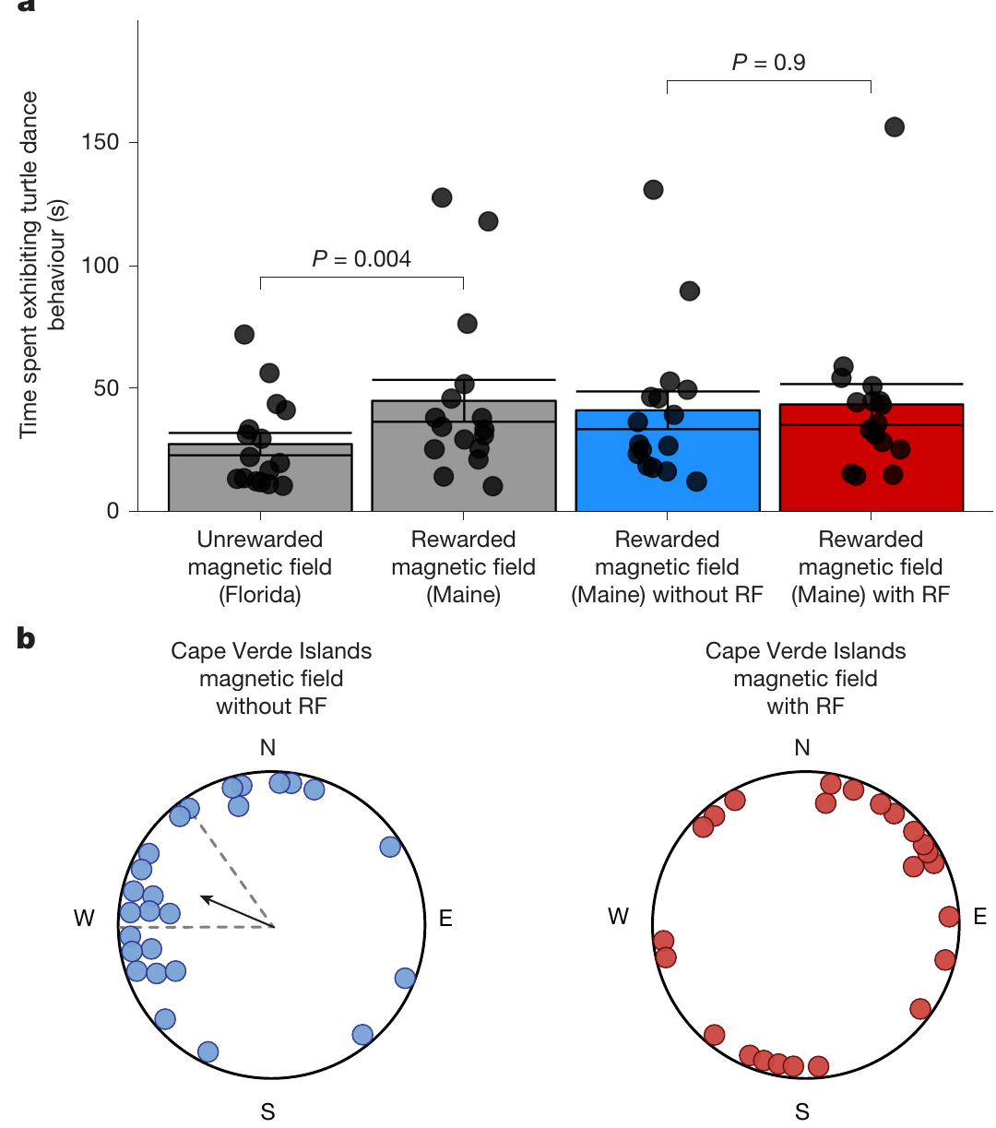
Radiofrequency disruption separates two turtle tasks
Radiofrequency fields are rapidly oscillating electromagnetic fields. Goforth and colleagues used broadband magnetic noise spanning 0.1–10 MHz to compare a learned map-only assay with a hatchling orientation task requiring map and compass information. The same class of perturbation was tested against different behavioral outputs.
The learned rewarded-field response persisted with radiofrequency exposure. In contrast, hatchlings exposed to the Cape Verde signature lost their consistent group heading under the noise treatment. Without noise, their reported preferred direction was 293.1°, approximately westward; with noise, the group no longer maintained a shared direction.
The dissociation is consistent with different mechanisms contributing to map and compass behavior. The learned map response persisted with radiofrequency noise, whereas the compass-dependent heading was lost, and the two tasks used different developmental stages and preparations.
Goforth et al. (2025), Fig. 5(a–b). Radiofrequency fields spare learned maps but disrupt orientation.
Goforth et al. (2025)
16
Notes:
• Radiofrequency fields are rapidly oscillating electromagnetic fields. Goforth and colleagues used broadband magnetic noise spanning 0.1–10 MHz to compare a learned map-only assay with a hatchling orientation task requiring map and compass information. The same class of perturbation was tested against different behavioral outputs.
– A negative disruption result must be limited to the applied exposure. Persistence of map discrimination under 0.1–10 MHz noise does not prove that every possible oscillating field is ineffective, and compass disruption alone does not identify cryptochrome in turtles.
• The learned rewarded-field response persisted with radiofrequency exposure. In contrast, hatchlings exposed to the Cape Verde signature lost their consistent group heading under the noise treatment. Without noise, their reported preferred direction was 293.1°, approximately westward; with noise, the group no longer maintained a shared direction.
• The dissociation is consistent with different mechanisms contributing to map and compass behavior. The learned map response persisted with radiofrequency noise, whereas the compass-dependent heading was lost, and the two tasks used different developmental stages and preparations.
References:
Goforth KM, Lohmann CMF, Gavin A, Henning R, Harvey A, Hinton TL, Lim DS, Lohmann KJ (2025). Learned magnetic map cues and two mechanisms of magnetoreception in turtles. Nature 638(8052):1015-1022. https://doi.org/10.1038/s41586-024-08554-y
Figure: Goforth et al. (2025), Fig. 5(a–b). Radiofrequency fields spare learned maps but disrupt orientation.
Figure source: https://doi.org/10.1038/s41586-024-08554-y

Slide 23
A dissociation shows that two tasks use different mechanisms
A dissociation occurs when a manipulation changes one behavior and leaves another unchanged. It suggests that the two behaviors rely on different mechanisms. The same class of perturbation was tested against two different behavioral outputs.
Goforth and colleagues exposed turtles to broadband radiofrequency noise from 0.1 to 10 MHz. The learned rewarded-field response persisted, whereas hatchlings exposed to the Cape Verde signature lost their group heading. Hatchlings were oriented in a harness and their heading was recorded.
Without noise, the hatchlings preferred 293.1°, approximately westward, and with noise the group no longer shared a direction. The map-only assay and the orientation task requiring map and compass information therefore respond differently to the same perturbation. Selective loss of one behavior shows that it depends on a process that the noise disrupts.
Goforth et al. (2025), Fig. 5(a–b). Radiofrequency fields spare learned maps but disrupt orientation.
Goforth et al. (2025)
16a
Notes:
• A selective effect of a manipulation points to separate mechanisms.
• Definition.
– A dissociation is a change in one behavior with another behavior spared.
• Manipulation.
– Radiofrequency fields are rapidly oscillating electromagnetic fields.
– Broadband noise spanned 0.1 to 10 megahertz.
• Map-only assay.
– The learned rewarded-field response persisted with the noise.
• Orientation task.
– Hatchlings exposed to the Cape Verde signature lost a consistent group heading with noise.
– Without noise they preferred 293.1 degrees.
• Interpretation.
– Different mechanisms may contribute to the map and to the compass.
• Preparations.
– The two tasks used different developmental stages, so the comparison is between behaviors and not between receptors in one animal.
• Radiofrequency fields.
– These are rapidly oscillating electromagnetic fields.
– They are used as a perturbation that may disturb radical-pair processes.
• Interpretation.
– The map and the compass may use different mechanisms.
– The result does not name either mechanism.
– Only the compass-dependent task lost its group heading under the noise.
References:
Goforth KM, Lohmann CMF, Gavin A, Henning R, Harvey A, Hinton TL, Lim DS, Lohmann KJ (2025). Learned magnetic map cues and two mechanisms of magnetoreception in turtles. Nature 638(8052):1015-1022. https://doi.org/10.1038/s41586-024-08554-y

Slide 24
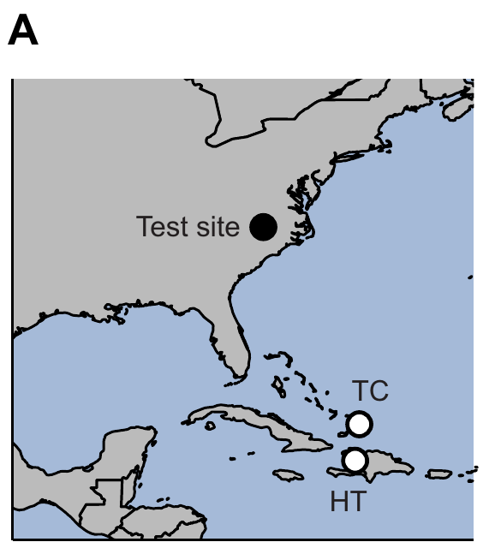
A learned map response enables a magnetic-pulse test
Mackiewicz and colleagues conditioned young loggerheads with signatures representing Turks and Caicos and Haiti. Animals learned which field predicted food, with the rewarded location counterbalanced. Testing again quantified turtle dancing rather than a compass heading, preserving the separation between positional cue recognition and directed swimming.
Conditioning alternated rewarded and unrewarded sessions over 2 months. Turtles received food 5–15 min after the field changed during rewarded sessions. Initial tests without food confirmed greater responding in the rewarded field before the magnetic-pulse treatments were introduced.
A magnetic pulse is a strong, brief field intended to alter magnetization in iron-based candidate receptors. The task provides an opportunity to perturb a learned map response without requiring compass use. A pulse that changes learned map responses would support a magnetization-based receptor mechanism for the map.
Mackiewicz et al. (2025), Fig. 1(A). Locations of learned magnetic signatures in the pulse experiment.
Mackiewicz et al. (2025); Goforth et al. (2025)
17
Notes:
• Mackiewicz and colleagues conditioned young loggerheads with signatures representing Turks and Caicos and Haiti. Animals learned which field predicted food, with the rewarded location counterbalanced. Testing again quantified turtle dancing rather than a compass heading, preserving the separation between positional cue recognition and directed swimming.
– Magnetite is an iron oxide that can carry a magnetic moment. A particle-based transduction hypothesis predicts that remagnetization can disturb a sensory signal, but a behavioral pulse effect is not itself a microscopic identification of such a particle.
• Conditioning alternated rewarded and unrewarded sessions over 2 months. Turtles received food 5–15 min after the field changed during rewarded sessions. Initial tests without food confirmed greater responding in the rewarded field before the magnetic-pulse treatments were introduced.
• A magnetic pulse is a strong, brief field intended to alter magnetization in iron-based candidate receptors. The task provides an opportunity to perturb a learned map response without requiring compass use. A pulse that changes learned map responses would support a magnetization-based receptor mechanism for the map.
References:
Mackiewicz AG, Glazener AM, Goforth KM, Lim DS, Lohmann CMF, Lohmann KJ (2025). Disruption of the sea turtle magnetic map sense by a magnetic pulse. Journal of Experimental Biology 228(22):jeb251243. https://doi.org/10.1242/jeb.251243
Goforth KM, Lohmann CMF, Gavin A, Henning R, Harvey A, Hinton TL, Lim DS, Lohmann KJ (2025). Learned magnetic map cues and two mechanisms of magnetoreception in turtles. Nature 638(8052):1015-1022. https://doi.org/10.1038/s41586-024-08554-y
Figure: Mackiewicz et al. (2025), Fig. 1(A). Locations of learned magnetic signatures in the pulse experiment.
Figure source: https://doi.org/10.1242/jeb.251243

Slide 25
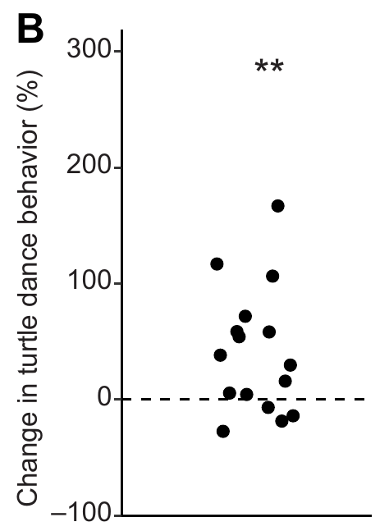
Sham handling controls the pulse experiment
Turtles were assessed after no-pulse, sham-pulse and actual-pulse treatments. Sham animals were handled in the magnetizer without receiving a pulse. The actual treatment lasted 5 ms and reached a maximum intensity of 85 mT, far stronger than the Earth-strength fields used for ordinary magnetic discrimination.
Sham and actual treatments were followed by at least 12 h of overnight recovery before testing. Controls were completed before the pulse treatment to prevent a previous pulse from contaminating control behavior. The order of the two control conditions was randomized, and observers scoring video were blind to treatment.
These precautions separate pulse exposure from much of the handling disturbance. The initial conditioning result establishes a measurable learned response against which the subsequent perturbation can be assessed, and the controls were completed before the pulse treatment so that a previous pulse could not contaminate them.
Mackiewicz et al. (2025), Fig. 1(B). Conditioning establishes magnetic field discrimination.
Mackiewicz et al. (2025)
18
Notes:
• Turtles were assessed after no-pulse, sham-pulse and actual-pulse treatments. Sham animals were handled in the magnetizer without receiving a pulse. The actual treatment lasted 5 ms and reached a maximum intensity of 85 mT, far stronger than the Earth-strength fields used for ordinary magnetic discrimination.
– A sham control reproduces the nonmagnetic components of an intervention. It cannot remove every conceivable effect of the actual pulse, but it tests whether placement in the apparatus and handling alone account for the change in behavior.
• Sham and actual treatments were followed by at least 12 h of overnight recovery before testing. Controls were completed before the pulse treatment to prevent a previous pulse from contaminating control behavior. The order of the two control conditions was randomized, and observers scoring video were blind to treatment.
• These precautions separate pulse exposure from much of the handling disturbance. The initial conditioning result establishes a measurable learned response against which the subsequent perturbation can be assessed, and the controls were completed before the pulse treatment so that a previous pulse could not contaminate them.
References:
Mackiewicz AG, Glazener AM, Goforth KM, Lim DS, Lohmann CMF, Lohmann KJ (2025). Disruption of the sea turtle magnetic map sense by a magnetic pulse. Journal of Experimental Biology 228(22):jeb251243. https://doi.org/10.1242/jeb.251243
Figure: Mackiewicz et al. (2025), Fig. 1(B). Conditioning establishes magnetic field discrimination.
Figure source: https://doi.org/10.1242/jeb.251243

Slide 26
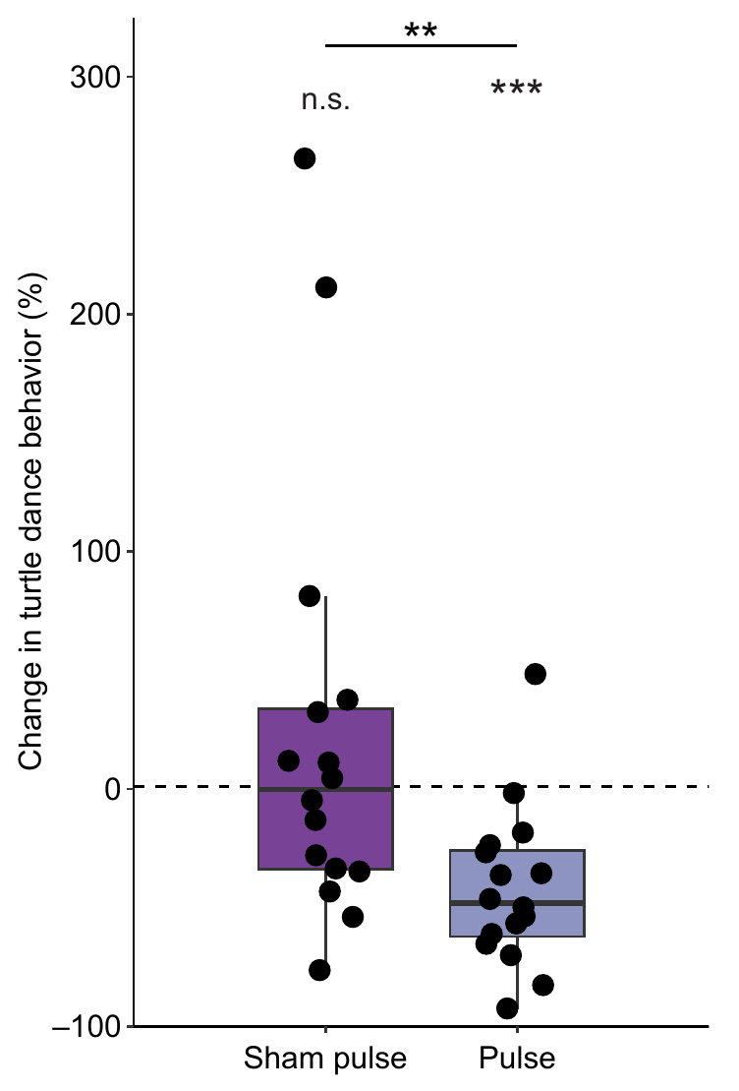
A strong pulse weakens learned field recognition
After a magnetic pulse, turtles spent less time dancing in their rewarded field relative to the no-pulse condition. Sham handling did not cause the same reduction. Pulse directions parallel and antiparallel to the horizontal Earth field did not produce distinguishable responses in this preparation and were considered together.
The result is consistent with disturbance of a particle-based map mechanism. A brief pulse could alter the arrangement or magnetic moments of magnetite-containing structures, whereas it is not expected to leave the same persistent change in a radical-pair reaction. These are mechanistic predictions used to interpret the behavioral effect.
Pulse sensitivity supports a candidate class of mechanism, magnetite-containing structures whose magnetic moments a strong pulse could alter. The receptor cells, their connection to a sensory nerve and the ion channel through which a particle might affect membrane voltage are the elements that a complete receptor pathway would include.
Mackiewicz et al. (2025), Fig. 2. A magnetic pulse reduces the response to the rewarded field.
Mackiewicz et al. (2025); Goforth et al. (2025)
19
Notes:
• After a magnetic pulse, turtles spent less time dancing in their rewarded field relative to the no-pulse condition. Sham handling did not cause the same reduction. Pulse directions parallel and antiparallel to the horizontal Earth field did not produce distinguishable responses in this preparation and were considered together.
– The map-only task is important because reduced directional swimming could reflect either compass impairment or failed location recognition. Here the measured change concerns a learned magnetic discrimination response rather than the ability to maintain a bearing.
• The result is consistent with disturbance of a particle-based map mechanism. A brief pulse could alter the arrangement or magnetic moments of magnetite-containing structures, whereas it is not expected to leave the same persistent change in a radical-pair reaction. These are mechanistic predictions used to interpret the behavioral effect.
• Pulse sensitivity supports a candidate class of mechanism, magnetite-containing structures whose magnetic moments a strong pulse could alter. The receptor cells, their connection to a sensory nerve and the ion channel through which a particle might affect membrane voltage are the elements that a complete receptor pathway would include.
References:
Mackiewicz AG, Glazener AM, Goforth KM, Lim DS, Lohmann CMF, Lohmann KJ (2025). Disruption of the sea turtle magnetic map sense by a magnetic pulse. Journal of Experimental Biology 228(22):jeb251243. https://doi.org/10.1242/jeb.251243
Goforth KM, Lohmann CMF, Gavin A, Henning R, Harvey A, Hinton TL, Lim DS, Lohmann KJ (2025). Learned magnetic map cues and two mechanisms of magnetoreception in turtles. Nature 638(8052):1015-1022. https://doi.org/10.1038/s41586-024-08554-y
Figure: Mackiewicz et al. (2025), Fig. 2. A magnetic pulse reduces the response to the rewarded field.
Figure source: https://doi.org/10.1242/jeb.251243

Slide 27
Magnetite and radical pairs make different predictions
Magnetite is an iron oxide whose particles have a magnetic moment, so a strong pulse can change their arrangement or magnetization. A radical-pair reaction is a chemical process that is influenced by a field only while it is present.
Mackiewicz and colleagues gave turtles a magnetic pulse lasting 5 ms with a maximum of 85 mT. Turtles danced less in their rewarded field after the pulse than after no pulse, and sham handling did not produce the reduction.
A persistent effect of a brief pulse fits a particle-based mechanism better than a radical-pair mechanism. The result therefore supports magnetite-containing structures as a candidate for the map while the receptor itself has not been located.
Mackiewicz et al. (2025), Fig. 2. A magnetic pulse reduces the response to the rewarded field.
Mackiewicz et al. (2025)
19a
Notes:
• The two main receptor hypotheses behave differently after a strong pulse.
• Magnetite.
– Magnetite is an iron oxide that can interact with magnetic fields.
– A pulse can alter its magnetic arrangement.
• Radical pair.
– A radical-pair reaction depends on the field while it is present.
– A brief pulse is not expected to leave a persistent change.
• Pulse.
– The pulse lasted 5 milliseconds and reached 85 millitesla.
– That is far stronger than Earth-strength fields.
• Controls.
– No-pulse, sham-pulse and actual-pulse treatments were compared.
– Sham handling did not cause the reduction.
• Result.
– Turtles danced less in the rewarded field after the pulse.
• Directions.
– Pulses parallel and antiparallel to the horizontal Earth field were considered together.
• Why direction of the pulse did not matter.
– Pulses parallel and antiparallel to the horizontal field did not produce distinguishable responses and were treated together.
• Controls.
– Sham animals were handled in the magnetizer without a pulse.
– Observers scoring video did not know the treatment.
References:
Mackiewicz AG, Glazener AM, Goforth KM, Lim DS, Lohmann CMF, Lohmann KJ (2025). Disruption of the sea turtle magnetic map sense by a magnetic pulse. Journal of Experimental Biology 228(22):jeb251243. https://doi.org/10.1242/jeb.251243

Slide 28
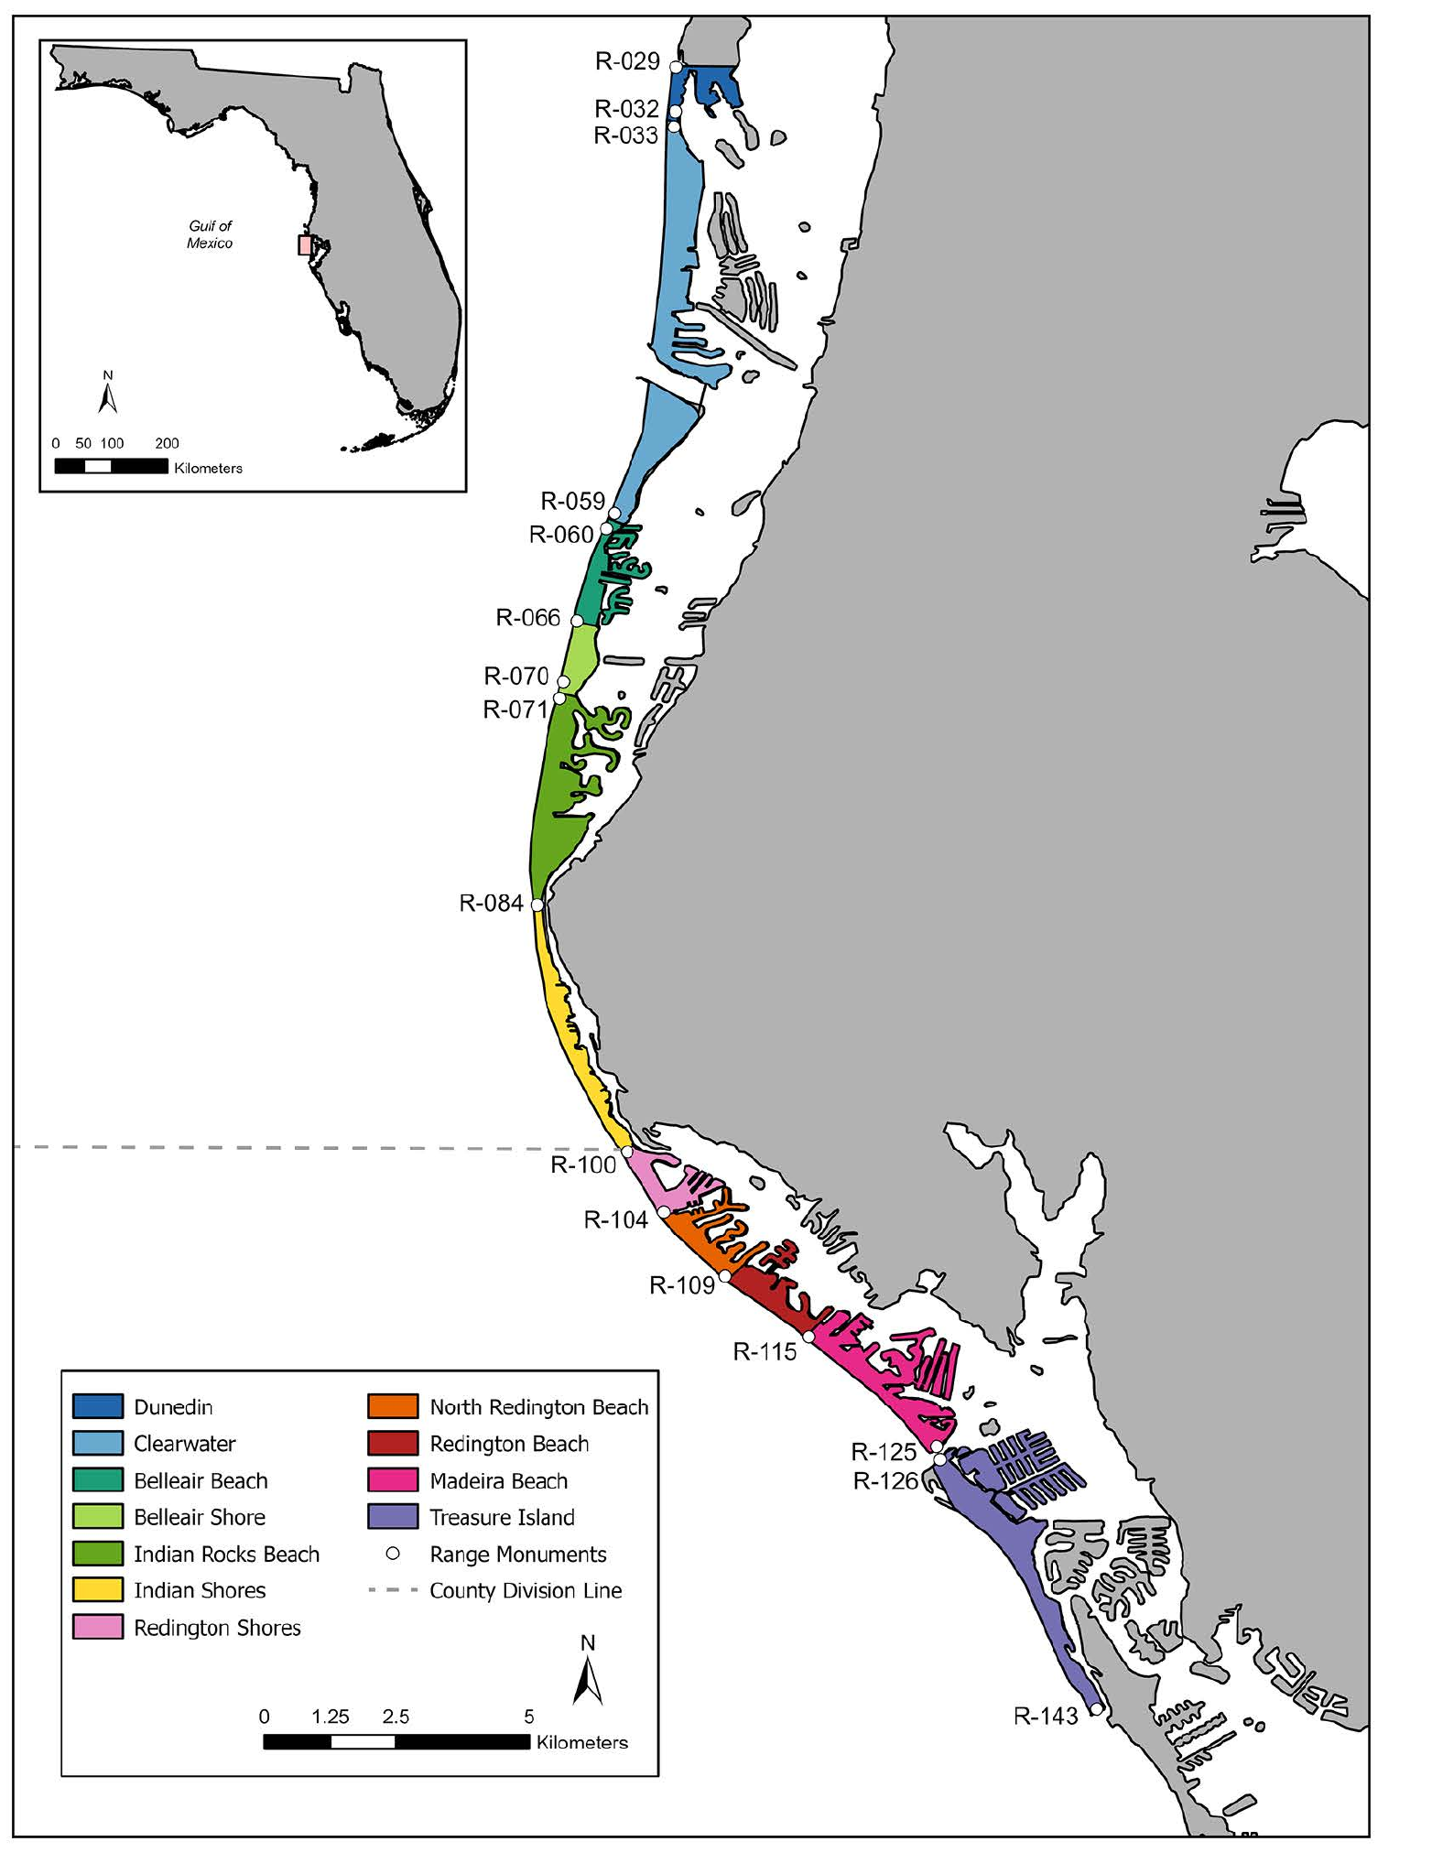
Coastal disorientation can involve competing light cues
McNally and colleagues examined loggerhead nesting records from Pinellas County, Florida. Their study mapped nesting beaches alongside developed shorelines and classified hatchling disorientation events. This field context concerns the initial movement from nest to sea rather than the controlled offshore magnetic-compass preparations.
Across the recorded nests, disorientation occurred in 35.18%, and roughly 30.48% of hatchlings from affected nests were classified as disoriented. The authors evaluated shoreline context, nest characteristics and spatial patterns. These observational measures document a substantial problem at the transition between terrestrial emergence and marine migration.
Artificial light on a developed beach can compete with orientation cues, and the observational records document how often hatchlings fail to reach the sea. Controlled laboratory experiments with magnetic fields address the sensory basis of a compass, and beach disorientation concerns a separate stage of the journey.
McNally et al. (2026), Fig. 1. Published map of nesting beaches and developed shorelines.
McNally et al. (2026)
20
Notes:
• McNally and colleagues examined loggerhead nesting records from Pinellas County, Florida. Their study mapped nesting beaches alongside developed shorelines and classified hatchling disorientation events. This field context concerns the initial movement from nest to sea rather than the controlled offshore magnetic-compass preparations.
– Disorientation refers to hatchlings failing to proceed appropriately toward the ocean. The field records describe an ecological outcome influenced by multiple cues; their observational associations cannot establish a specific neural or magnetic causal mechanism.
• Across the recorded nests, disorientation occurred in 35.18%, and roughly 30.48% of hatchlings from affected nests were classified as disoriented. The authors evaluated shoreline context, nest characteristics and spatial patterns. These observational measures document a substantial problem at the transition between terrestrial emergence and marine migration.
• Artificial light on a developed beach can compete with orientation cues, and the observational records document how often hatchlings fail to reach the sea. Controlled laboratory experiments with magnetic fields address the sensory basis of a compass, and beach disorientation concerns a separate stage of the journey.
References:
McNally KL, Oakley C, Davila M, Farinelli S (2026). Disorientation patterns of loggerhead sea turtle (Caretta caretta) hatchlings in Pinellas County, Florida, USA. PLOS One 21(4):e0347104. https://doi.org/10.1371/journal.pone.0347104
Figure: McNally et al. (2026), Fig. 1. Published map of nesting beaches and developed shorelines.
Figure source: https://doi.org/10.1371/journal.pone.0347104

Slide 29
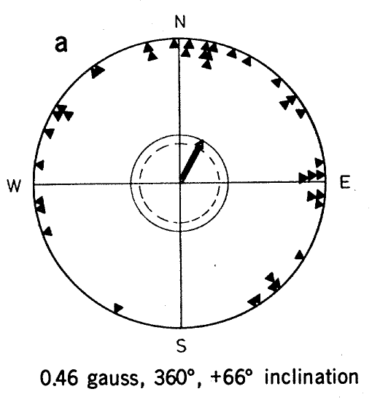
European robins express a magnetic migratory heading
European robins, Erithacus rubecula, display migratory restlessness, directional activity expressed during the season when they would normally migrate. Wiltschko and Wiltschko used the frequency of perch activation in circular cages to measure preferred direction without requiring birds to undertake a free flight.
In spring, robins tested in the local field preferred 29°, north-northeast. The historical study reported a field strength of 0.46 gauss and an inclination of +66°. The behavioral readout therefore related a seasonal directional tendency to a controlled geomagnetic configuration.
The experiment concerns a compass because it measures direction rather than a location-dependent correction toward a distant target. Perch activation provides a simple orientation measure that is recorded without a free flight.
Wiltschko & Wiltschko (1972), Fig. 1(a). European robin orientation in the local magnetic field.
Wiltschko & Wiltschko (1972)
21
Notes:
• European robins, Erithacus rubecula, display migratory restlessness, directional activity expressed during the season when they would normally migrate. Wiltschko and Wiltschko used the frequency of perch activation in circular cages to measure preferred direction without requiring birds to undertake a free flight.
– Migratory state supplies the behavioral context. A sensory compass can guide different seasonal directions, so a spring northerly preference is an interaction between magnetic direction information and the animal’s current migratory program.
• In spring, robins tested in the local field preferred 29°, north-northeast. The historical study reported a field strength of 0.46 gauss and an inclination of +66°. The behavioral readout therefore related a seasonal directional tendency to a controlled geomagnetic configuration.
• The experiment concerns a compass because it measures direction rather than a location-dependent correction toward a distant target. Perch activation provides a simple orientation measure that is recorded without a free flight.
References:
Wiltschko W, Wiltschko R (1972). Magnetic Compass of European Robins. Science 176(4030):62-64. https://doi.org/10.1126/science.176.4030.62
Figure: Wiltschko & Wiltschko (1972), Fig. 1(a). European robin orientation in the local magnetic field.
Figure source: https://doi.org/10.1126/science.176.4030.62

Slide 30
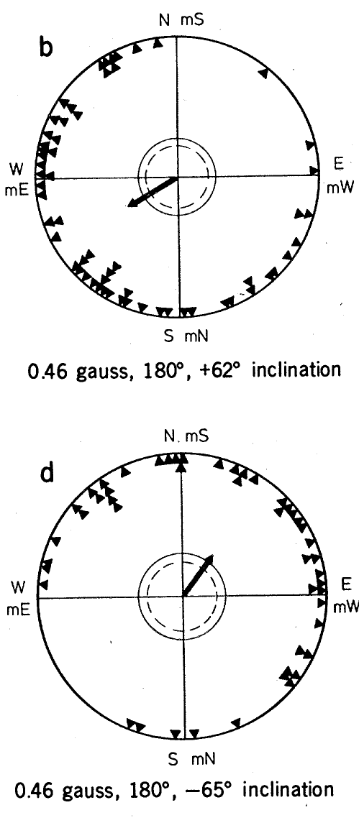
The robin compass follows inclination rather than polarity
A polarity compass distinguishes the two directed ends of a magnetic vector. An inclination compass uses the axial slope of field lines relative to the horizontal or gravity. Wiltschko and Wiltschko reversed individual field components and then reversed both to distinguish these alternatives.
Reversing the horizontal component changed the preferred course from 29° to 240°. Reversing both horizontal and vertical components preserved the field axis despite reversing vector polarity. Robins then retained a northerly preference, which is incompatible with treating magnetic polarity alone as the directional cue.
The behavioral pattern supports an inclination-based compass. An inclination compass reads the axis of the field lines relative to gravity, so reversing both components preserves the information that the bird uses.
Wiltschko & Wiltschko (1972), Fig. 1(b,d). Horizontal reversal and full polarity reversal have different effects.
Wiltschko & Wiltschko (1972)
22
Notes:
• A polarity compass distinguishes the two directed ends of a magnetic vector. An inclination compass uses the axial slope of field lines relative to the horizontal or gravity. Wiltschko and Wiltschko reversed individual field components and then reversed both to distinguish these alternatives.
– Field axis and field polarity are different properties. Reversing both components changes the direction of the vector while retaining the same undirected line in space, which is why the two compass hypotheses predict different behavioral outcomes.
• Reversing the horizontal component changed the preferred course from 29° to 240°. Reversing both horizontal and vertical components preserved the field axis despite reversing vector polarity. Robins then retained a northerly preference, which is incompatible with treating magnetic polarity alone as the directional cue.
• The behavioral pattern supports an inclination-based compass. An inclination compass reads the axis of the field lines relative to gravity, so reversing both components preserves the information that the bird uses.
References:
Wiltschko W, Wiltschko R (1972). Magnetic Compass of European Robins. Science 176(4030):62-64. https://doi.org/10.1126/science.176.4030.62
Figure: Wiltschko & Wiltschko (1972), Fig. 1(b,d). Horizontal reversal and full polarity reversal have different effects.
Figure source: https://doi.org/10.1126/science.176.4030.62

Slide 31
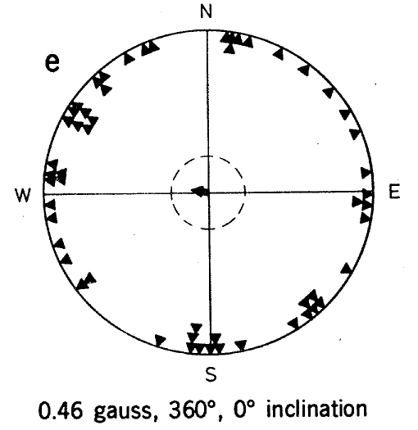
A horizontal field removes the robin directional preference
The historical experiments also used a field of 0.46 gauss with zero inclination. Its horizontal direction and total strength were maintained, but the field no longer had a downward or upward slope. This manipulation tested whether horizontal magnetic polarity was enough to guide a shared migratory preference.
Robins did not express a consistent direction under that horizontal condition. Together with the component-reversal experiments, this result supports use of inclination relative to the animal’s up–down reference. In the northern hemisphere, an inclined axis permits a distinction between poleward and equatorward directions.
The result shows that the directional code of the compass depends on the inclined axis of the field relative to the up–down reference of the bird, and a horizontal field does not supply it.
Wiltschko & Wiltschko (1972), Fig. 1(e). Robins lose directional preference in a horizontal field.
Wiltschko & Wiltschko (1972)
23
Notes:
• The historical experiments also used a field of 0.46 gauss with zero inclination. Its horizontal direction and total strength were maintained, but the field no longer had a downward or upward slope. This manipulation tested whether horizontal magnetic polarity was enough to guide a shared migratory preference.
– The conclusion depends on the pattern across several field configurations. A single disorientation treatment can have many explanations, whereas component reversal and preserved behavior after full polarity reversal constrain the information available to the animal.
• Robins did not express a consistent direction under that horizontal condition. Together with the component-reversal experiments, this result supports use of inclination relative to the animal’s up–down reference. In the northern hemisphere, an inclined axis permits a distinction between poleward and equatorward directions.
• The result shows that the directional code of the compass depends on the inclined axis of the field relative to the up–down reference of the bird, and a horizontal field does not supply it.
References:
Wiltschko W, Wiltschko R (1972). Magnetic Compass of European Robins. Science 176(4030):62-64. https://doi.org/10.1126/science.176.4030.62
Figure: Wiltschko & Wiltschko (1972), Fig. 1(e). Robins lose directional preference in a horizontal field.
Figure source: https://doi.org/10.1126/science.176.4030.62

Slide 32
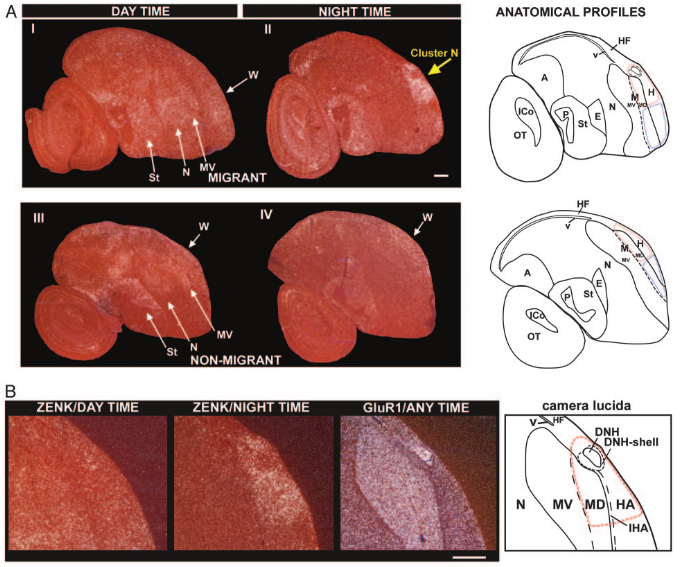
Cluster N is active during nocturnal vision
Mouritsen and colleagues used activity-associated gene expression to identify brain regions recruited during night vision. They measured ZENK, an immediate-early transcriptional marker whose expression changes with neuronal activation. Migratory garden warblers and European robins were compared with non-migratory zebra finches and canaries.
Birds were exposed to dim illumination approximating moonlight, 0.04 lux, or ordinary daytime room light. Brain sections revealed a dorsal forebrain region designated Cluster N with strong night-time expression in migrants. The anatomical preparation linked a defined group of forebrain regions to a controlled visual condition.
ZENK expression is an indirect activity measure integrated over time rather than an instantaneous spike recording. Cluster N is therefore a candidate processing region for night vision in migratory songbirds, and its activity can reflect visual sensitivity, magnetic information or other orientation cues.
Mouritsen et al. (2005), Fig. 1(A–B). Activity-associated gene expression marks Cluster N anatomy.
Mouritsen et al. (2005)
24
Notes:
• Mouritsen and colleagues used activity-associated gene expression to identify brain regions recruited during night vision. They measured ZENK, an immediate-early transcriptional marker whose expression changes with neuronal activation. Migratory garden warblers and European robins were compared with non-migratory zebra finches and canaries.
– The authors collected brains after birds had been relatively still and awake, limiting movement-related expression. That control strengthens the association with the sensory condition without turning a gene-expression marker into proof of a magnetic receptor.
• Birds were exposed to dim illumination approximating moonlight, 0.04 lux, or ordinary daytime room light. Brain sections revealed a dorsal forebrain region designated Cluster N with strong night-time expression in migrants. The anatomical preparation linked a defined group of forebrain regions to a controlled visual condition.
• ZENK expression is an indirect activity measure integrated over time rather than an instantaneous spike recording. Cluster N is therefore a candidate processing region for night vision in migratory songbirds, and its activity can reflect visual sensitivity, magnetic information or other orientation cues.
References:
Mouritsen H, Feenders G, Liedvogel M, Wada K, Jarvis ED (2005). Night-vision brain area in migratory songbirds. Proceedings of the National Academy of Sciences 102(23):8339-8344. https://doi.org/10.1073/pnas.0409575102
Figure: Mouritsen et al. (2005), Fig. 1(A–B). Activity-associated gene expression marks Cluster N anatomy.
Figure source: https://doi.org/10.1073/pnas.0409575102

Slide 33
Immediate-early genes mark recently active neurons
ZENK is an immediate-early gene whose expression rises in neurons shortly after they are activated. Measuring its product in tissue sections reveals which regions were recruited during a behavior. The measure is applied to brain sections after the birds have been exposed to the condition.
Mouritsen and colleagues exposed migratory garden warblers and European robins and non-migratory zebra finches and canaries to dim light of 0.04 lux or to ordinary daytime light. A dorsal forebrain region called Cluster N showed strong night-time expression in migrants. The dim light approximated moonlight.
The measure integrates activity over time and is not an instantaneous spike record. It therefore identifies a candidate region that is recruited during night vision in migratory birds.
Mouritsen et al. (2005), Fig. 1(A–B). Activity-associated gene expression marks Cluster N anatomy.
Mouritsen et al. (2005)
24a
Notes:
• A molecular marker can show where the brain was active during an experience.
• Marker.
– ZENK is an immediate-early transcriptional marker whose expression changes with neuronal activation.
• Species.
– Migratory garden warblers and European robins were compared with non-migratory zebra finches and canaries.
• Conditions.
– Birds were exposed to dim light of 0.04 lux or to ordinary daytime room light.
• Result.
– Brain sections revealed Cluster N, a dorsal forebrain region.
– Cluster N expression was strong at night in migrants.
• Time scale.
– ZENK reports activity integrated over time and does not report individual spikes.
• Meaning.
– Cluster N is a candidate region for night vision, with visual, magnetic or other functions possible.
• Why compare species.
– Non-migratory zebra finches and canaries did not show the same nocturnal increase.
– Differences between species can reflect specialization for night vision.
• Light levels.
– Dim illumination was 0.04 lux, and daytime room illumination exceeded 275 lux.
– Recent movement was minimized before tissue collection.
References:
Mouritsen H, Feenders G, Liedvogel M, Wada K, Jarvis ED (2005). Night-vision brain area in migratory songbirds. Proceedings of the National Academy of Sciences 102(23):8339-8344. https://doi.org/10.1073/pnas.0409575102

Slide 34
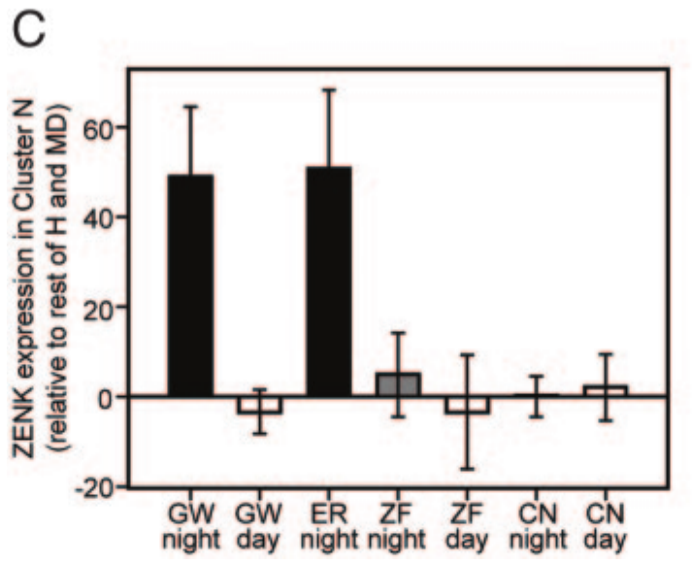
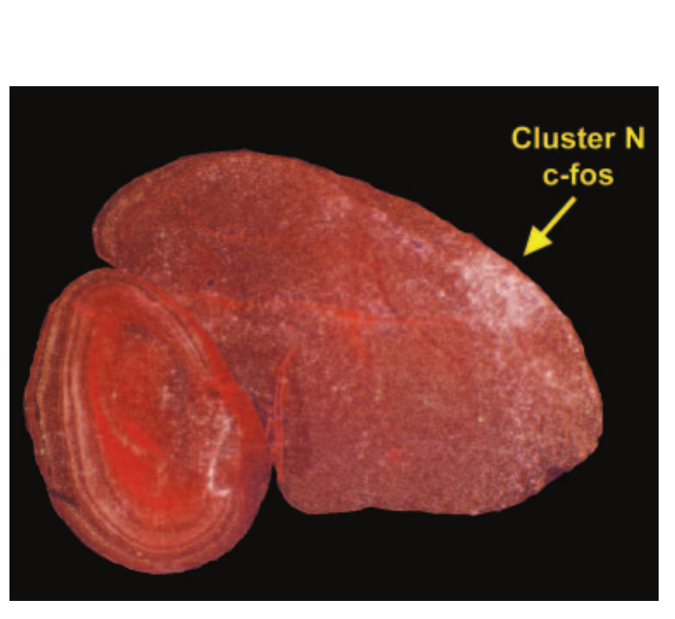
Nocturnal activation differs across species and conditions
Cluster N expression was stronger during night vision in the migratory species than during daytime testing. Non-migratory zebra finches and canaries did not exhibit the same nocturnal increase. The comparison therefore connected the response to both illumination conditions and the tested species’ ecological specialization.
The dim-light condition was 0.04 lux, whereas daytime room illumination exceeded 275 lux. Investigators also minimized recent movement before collecting brain tissue. The published expression measurements compare sensory states while reducing the possibility that flight or gross locomotor activity alone produced the regional difference.
Cluster N expression was higher at night in migratory species than in non-migratory species, which supports specialization of this region for nocturnal sensory processing. Minimizing recent movement before tissue collection reduced the possibility that flight alone produced the difference.
Mouritsen et al. (2005), Fig. 1(C). Cluster N activity differs between day, night and species.
Mouritsen et al. (2005), Fig. 2. Dorsal brain preparation and location of Cluster N.
Mouritsen et al. (2005)
25
Notes:
• Cluster N expression was stronger during night vision in the migratory species than during daytime testing. Non-migratory zebra finches and canaries did not exhibit the same nocturnal increase. The comparison therefore connected the response to both illumination conditions and the tested species’ ecological specialization.
– A regional gene-expression difference provides an anatomical hypothesis that requires functional tests. A necessary pathway is established more directly when manipulating the region selectively changes the target behavior while suitable control behaviors remain available.
• The dim-light condition was 0.04 lux, whereas daytime room illumination exceeded 275 lux. Investigators also minimized recent movement before collecting brain tissue. The published expression measurements compare sensory states while reducing the possibility that flight or gross locomotor activity alone produced the regional difference.
• Cluster N expression was higher at night in migratory species than in non-migratory species, which supports specialization of this region for nocturnal sensory processing. Minimizing recent movement before tissue collection reduced the possibility that flight alone produced the difference.
References:
Mouritsen H, Feenders G, Liedvogel M, Wada K, Jarvis ED (2005). Night-vision brain area in migratory songbirds. Proceedings of the National Academy of Sciences 102(23):8339-8344. https://doi.org/10.1073/pnas.0409575102
Figure: Mouritsen et al. (2005), Fig. 1(C). Cluster N activity differs between day, night and species.
Figure source: https://doi.org/10.1073/pnas.0409575102
Figure: Mouritsen et al. (2005), Fig. 2. Dorsal brain preparation and location of Cluster N.
Figure source: https://doi.org/10.1073/pnas.0409575102

Slide 35
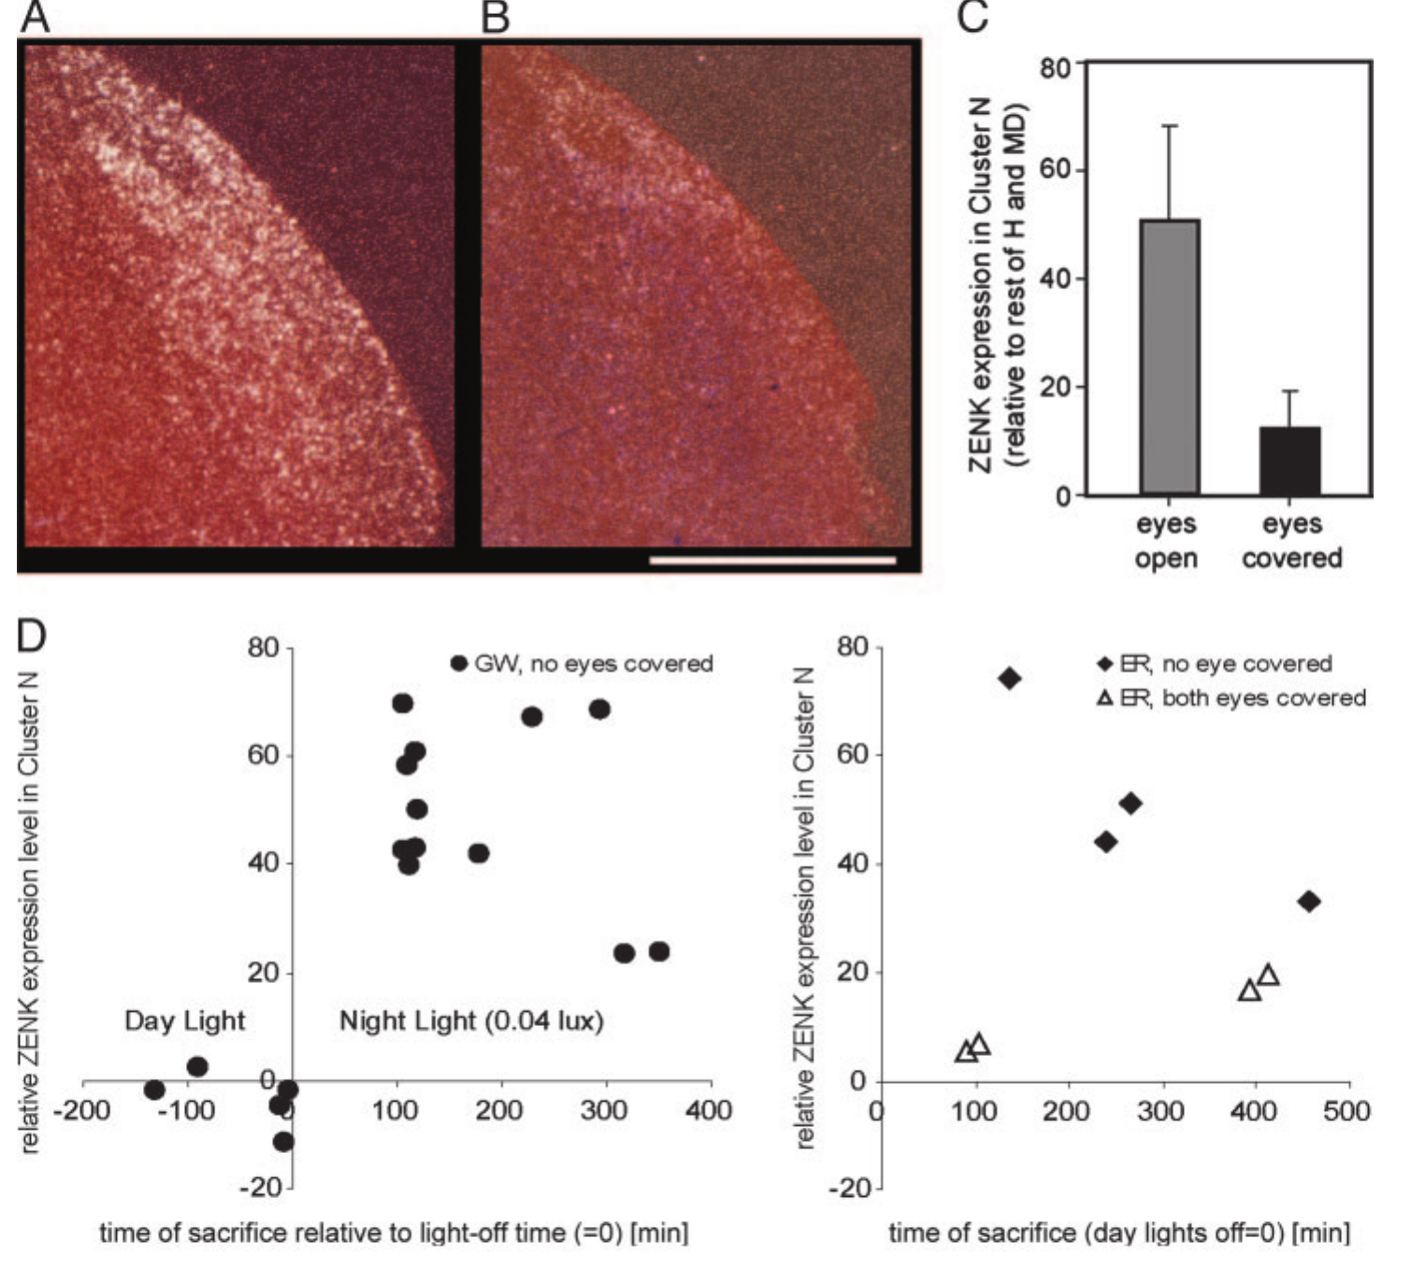
Covering the eyes suppresses Cluster N activation
To test dependence on visual input, Mouritsen and colleagues covered both eyes of European robins with light-tight caps during nocturnal testing. This manipulation prevented light from reaching the retina while retaining the general night-time context of the experiment. Control birds experienced the same dim-light period with uncovered eyes.
Cluster N activation fell markedly when both eyes were covered. The response therefore depends on input associated with vision rather than merely the time of night or an internal migratory state. The published histology pairs the anatomical signal with measurements of expression and observed behavior.
Eye covering blocks ordinary vision, so the fall in Cluster N activation places the region in a visually dependent processing pathway. More selective tests can then separate magnetic information from other dim-light visual signals.
Mouritsen et al. (2005), Fig. 3(A–E). Eye covering suppresses night-time Cluster N activation.
Mouritsen et al. (2005), Fig. 2. Dorsal brain preparation and location of Cluster N.
Mouritsen et al. (2005)
26
Notes:
• To test dependence on visual input, Mouritsen and colleagues covered both eyes of European robins with light-tight caps during nocturnal testing. This manipulation prevented light from reaching the retina while retaining the general night-time context of the experiment. Control birds experienced the same dim-light period with uncovered eyes.
– The retina is the light-sensitive tissue lining the eye. Removing retinal illumination changes many signals simultaneously, which is why eye occlusion is a pathway-dependence test rather than a molecularly selective magnetoreception experiment.
• Cluster N activation fell markedly when both eyes were covered. The response therefore depends on input associated with vision rather than merely the time of night or an internal migratory state. The published histology pairs the anatomical signal with measurements of expression and observed behavior.
• Eye covering blocks ordinary vision, so the fall in Cluster N activation places the region in a visually dependent processing pathway. More selective tests can then separate magnetic information from other dim-light visual signals.
References:
Mouritsen H, Feenders G, Liedvogel M, Wada K, Jarvis ED (2005). Night-vision brain area in migratory songbirds. Proceedings of the National Academy of Sciences 102(23):8339-8344. https://doi.org/10.1073/pnas.0409575102
Figure: Mouritsen et al. (2005), Fig. 3(A–E). Eye covering suppresses night-time Cluster N activation.
Figure source: https://doi.org/10.1073/pnas.0409575102
Figure: Mouritsen et al. (2005), Fig. 2. Dorsal brain preparation and location of Cluster N.
Figure source: https://doi.org/10.1073/pnas.0409575102

Slide 36
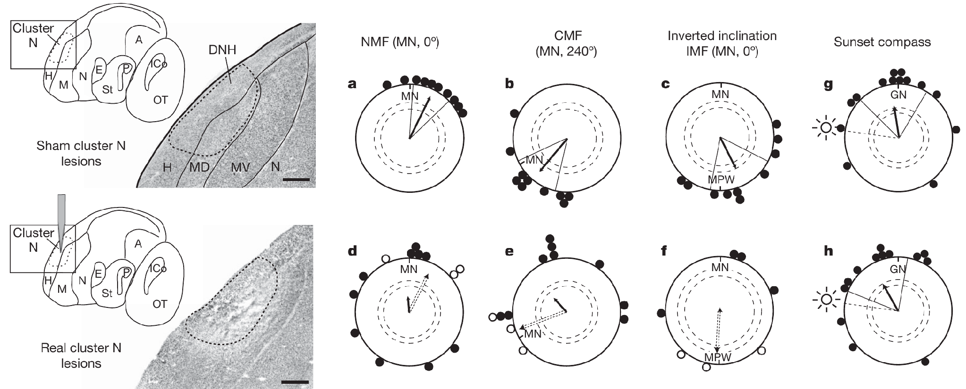
Cluster N lesions abolish magnetic compass orientation
Zapka and colleagues tested European robin orientation before and after bilateral chemical lesions of Cluster N. Ibotenic acid, the lesion agent, was injected locally; sham-operated birds underwent the corresponding procedure without the active injection. Subsequent tests followed at least 1 week of recovery.
Tests compared the natural magnetic field, a field with magnetic north rotated 120° anticlockwise, and an inverted vertical component. Sham-lesioned birds changed direction appropriately with the field manipulations. Cluster-N-lesioned birds failed to express coherent magnetic compass orientation across those conditions.
The intervention establishes that the damaged region is necessary for normal magnetic compass performance in this preparation. Sham-operated birds changed direction with each field manipulation, so the loss of orientation in lesioned birds is attributable to damage to Cluster N and not to the surgery.
Zapka et al. (2009), Fig. 2(a–h). Cluster N lesions abolish magnetic compass orientation.
Mouritsen et al. (2005), Fig. 2. Dorsal brain preparation and location of Cluster N.
Zapka et al. (2009); Mouritsen et al. (2005)
27
Notes:
• Zapka and colleagues tested European robin orientation before and after bilateral chemical lesions of Cluster N. Ibotenic acid, the lesion agent, was injected locally; sham-operated birds underwent the corresponding procedure without the active injection. Subsequent tests followed at least 1 week of recovery.
– A regional lesion interrupts multiple cells and their local interactions. The behavioral loss localizes a necessary processing stage more strongly than gene expression alone, but it cannot assign magnetic computation to one identified cell type or synapse.
• Tests compared the natural magnetic field, a field with magnetic north rotated 120° anticlockwise, and an inverted vertical component. Sham-lesioned birds changed direction appropriately with the field manipulations. Cluster-N-lesioned birds failed to express coherent magnetic compass orientation across those conditions.
• The intervention establishes that the damaged region is necessary for normal magnetic compass performance in this preparation. Sham-operated birds changed direction with each field manipulation, so the loss of orientation in lesioned birds is attributable to damage to Cluster N and not to the surgery.
References:
Zapka M, Heyers D, Hein CM, Engels S, Schneider NL, Hans J, Weiler S, Dreyer D, Kishkinev D, Wild JM, Mouritsen H (2009). Visual but not trigeminal mediation of magnetic compass information in a migratory bird. Nature 461(7268):1274-1277. https://doi.org/10.1038/nature08528
Mouritsen H, Feenders G, Liedvogel M, Wada K, Jarvis ED (2005). Night-vision brain area in migratory songbirds. Proceedings of the National Academy of Sciences 102(23):8339-8344. https://doi.org/10.1073/pnas.0409575102
Figure: Zapka et al. (2009), Fig. 2(a–h). Cluster N lesions abolish magnetic compass orientation.
Figure source: https://doi.org/10.1038/nature08528
Figure: Mouritsen et al. (2005), Fig. 2. Dorsal brain preparation and location of Cluster N.
Figure source: https://doi.org/10.1073/pnas.0409575102

Slide 37
A lesion tests whether a region is necessary
A lesion is damage to a region of tissue made to test whether the region is needed for a behavior. A sham operation repeats the surgery without the damaging step, so differences between lesioned and sham animals can be attributed to the damage.
Zapka and colleagues injected ibotenic acid into Cluster N of European robins and tested orientation after at least 1 week of recovery. Sham birds changed direction with the rotated and inverted magnetic fields, whereas lesioned birds failed to orient coherently.
The region is therefore necessary for normal magnetic compass performance in this preparation. A necessity result identifies a stage in the pathway and does not by itself show that every neuron in the region responds to magnetic fields.
Zapka et al. (2009), Fig. 2(a–h). Cluster N lesions abolish magnetic compass orientation.
Mouritsen et al. (2005), Fig. 2. Dorsal brain preparation and location of Cluster N.
Zapka et al. (2009)
27a
Notes:
• A lesion removes a region to test its role.
• Lesion and sham.
– A lesion damages a region.
– A sham operation repeats the procedure without the active injection.
• Method.
– Ibotenic acid was injected locally into Cluster N on both sides.
– Tests followed at least 1 week of recovery.
• Test fields.
– The natural field was compared with a field with magnetic north rotated 120 degrees anticlockwise.
– An inverted vertical component was also tested.
• Sham birds.
– They changed direction appropriately with the field manipulations.
• Lesioned birds.
– They failed to express coherent magnetic compass orientation.
• Meaning.
– Cluster N is necessary for the compass in this preparation, and its neurons need not all be magnetic.
• Selectivity.
– Lesioned birds still oriented with stars and at sunset.
– The loss of orientation is therefore specific to the magnetic compass.
• Inference.
– Cluster N is necessary for the tested compass behavior, and the neurons that respond to magnetic fields remain to be located within the pathway.
References:
Zapka M, Heyers D, Hein CM, Engels S, Schneider NL, Hans J, Weiler S, Dreyer D, Kishkinev D, Wild JM, Mouritsen H (2009). Visual but not trigeminal mediation of magnetic compass information in a migratory bird. Nature 461(7268):1274-1277. https://doi.org/10.1038/nature08528
Mouritsen H, Feenders G, Liedvogel M, Wada K, Jarvis ED (2005). Night-vision brain area in migratory songbirds. Proceedings of the National Academy of Sciences 102(23):8339-8344. https://doi.org/10.1073/pnas.0409575102

Slide 38
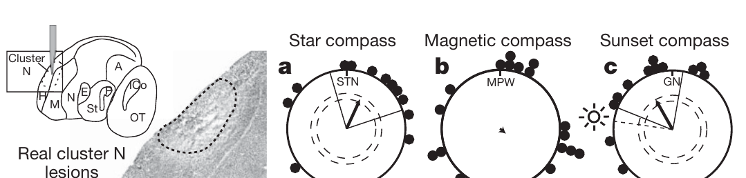
Celestial orientation survives the visual-region lesion
Cluster-N-lesioned birds retained orientation under a stationary planetarium sky simulating local stars. Lesioned and sham-operated birds also oriented during natural sunset. These tests assessed whether the intervention had caused a general inability to move directionally or use visual orientation information.
The preserved celestial responses contrast with loss of magnetic compass orientation. The sunset response included a tendency toward the setting sun, so the authors considered the interaction between migratory direction and phototaxis. The star test supplied an additional orientation condition under controlled celestial information.
The controls support a relatively selective magnetic-compass deficit rather than complete blindness or loss of all orientation behavior. Birds with Cluster N lesions oriented with stars and at sunset, so the deficit is specific to the magnetic compass among the tested orientation behaviors.
Zapka et al. (2009), Fig. 3(a–c). Lesioned birds retain star and sun compass orientation.
Mouritsen et al. (2005), Fig. 2. Dorsal brain preparation and location of Cluster N.
Zapka et al. (2009); Mouritsen et al. (2005)
28
Notes:
• Cluster-N-lesioned birds retained orientation under a stationary planetarium sky simulating local stars. Lesioned and sham-operated birds also oriented during natural sunset. These tests assessed whether the intervention had caused a general inability to move directionally or use visual orientation information.
– Phototaxis is directed movement toward or away from light. A sunset response can contain both light attraction and compass information, so a preserved directional response is useful as a control without requiring that every component be magnetically mediated.
• The preserved celestial responses contrast with loss of magnetic compass orientation. The sunset response included a tendency toward the setting sun, so the authors considered the interaction between migratory direction and phototaxis. The star test supplied an additional orientation condition under controlled celestial information.
• The controls support a relatively selective magnetic-compass deficit rather than complete blindness or loss of all orientation behavior. Birds with Cluster N lesions oriented with stars and at sunset, so the deficit is specific to the magnetic compass among the tested orientation behaviors.
References:
Zapka M, Heyers D, Hein CM, Engels S, Schneider NL, Hans J, Weiler S, Dreyer D, Kishkinev D, Wild JM, Mouritsen H (2009). Visual but not trigeminal mediation of magnetic compass information in a migratory bird. Nature 461(7268):1274-1277. https://doi.org/10.1038/nature08528
Mouritsen H, Feenders G, Liedvogel M, Wada K, Jarvis ED (2005). Night-vision brain area in migratory songbirds. Proceedings of the National Academy of Sciences 102(23):8339-8344. https://doi.org/10.1073/pnas.0409575102
Figure: Zapka et al. (2009), Fig. 3(a–c). Lesioned birds retain star and sun compass orientation.
Figure source: https://doi.org/10.1038/nature08528
Figure: Mouritsen et al. (2005), Fig. 2. Dorsal brain preparation and location of Cluster N.
Figure source: https://doi.org/10.1073/pnas.0409575102

Slide 39
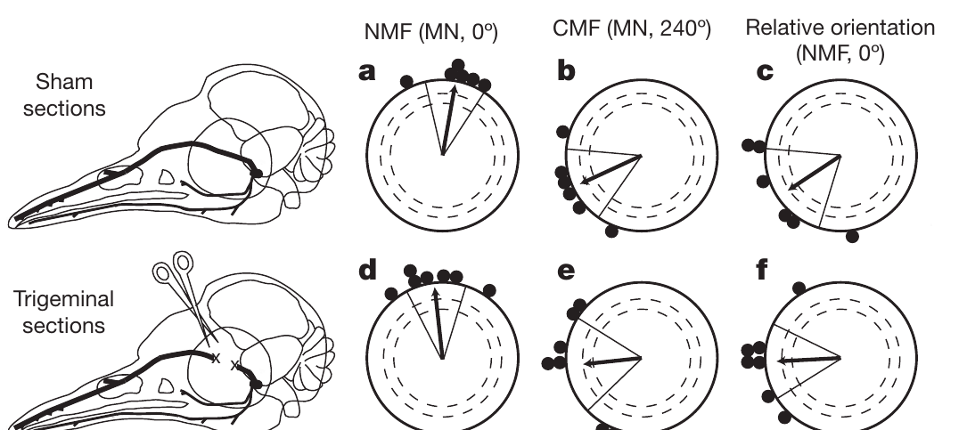
Trigeminal sections spare the robin magnetic compass
The ophthalmic branch of the trigeminal nerve, designated V1, carries sensory information from structures around the upper beak and head. Zapka and colleagues cut this branch bilaterally or performed sham surgery to test its necessity for the European robin’s magnetic compass.
Sham-operated birds preferred approximately 10° in the natural field and 245° after magnetic north was rotated. V1-sectioned birds preferred approximately 354° and 264°, respectively. Both groups therefore changed their headings with the experimentally rotated field despite the loss of this trigeminal input in one group.
The result means V1 is not necessary for the compass task under these conditions. Compass direction and location-related map information are different functions, and this experiment tested the compass and not a displacement correction.
Zapka et al. (2009), Fig. 1(a–f). Ophthalmic trigeminal sections spare the robin magnetic compass.
Zapka et al. (2009)
29
Notes:
• The ophthalmic branch of the trigeminal nerve, designated V1, carries sensory information from structures around the upper beak and head. Zapka and colleagues cut this branch bilaterally or performed sham surgery to test its necessity for the European robin’s magnetic compass.
– A nerve-section experiment establishes necessity for the behavior actually tested. Preserved compass performance after V1 section cannot be generalized to every navigational problem, especially a task that requires the bird to recognize geographical displacement.
• Sham-operated birds preferred approximately 10° in the natural field and 245° after magnetic north was rotated. V1-sectioned birds preferred approximately 354° and 264°, respectively. Both groups therefore changed their headings with the experimentally rotated field despite the loss of this trigeminal input in one group.
• The result means V1 is not necessary for the compass task under these conditions. Compass direction and location-related map information are different functions, and this experiment tested the compass and not a displacement correction.
References:
Zapka M, Heyers D, Hein CM, Engels S, Schneider NL, Hans J, Weiler S, Dreyer D, Kishkinev D, Wild JM, Mouritsen H (2009). Visual but not trigeminal mediation of magnetic compass information in a migratory bird. Nature 461(7268):1274-1277. https://doi.org/10.1038/nature08528
Figure: Zapka et al. (2009), Fig. 1(a–f). Ophthalmic trigeminal sections spare the robin magnetic compass.
Figure source: https://doi.org/10.1038/nature08528

Slide 40
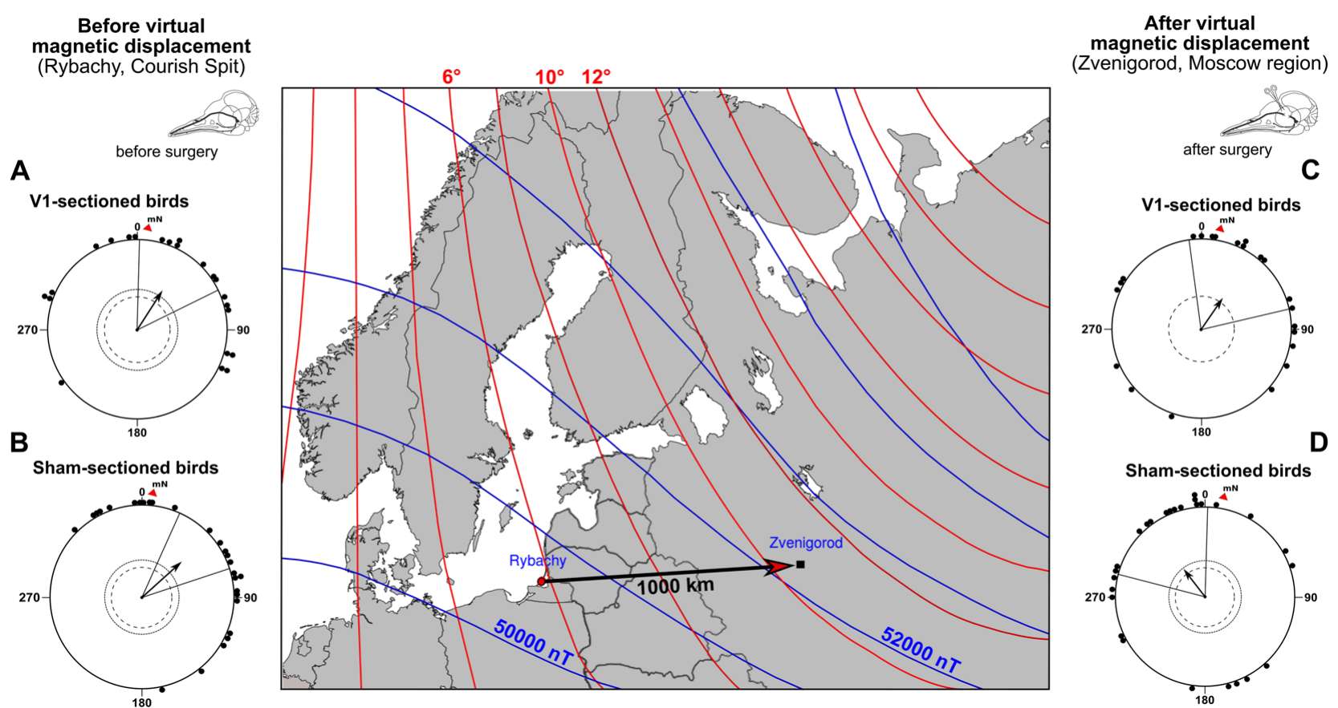
Virtual displacement tests the bird magnetic map
Pakhomov and colleagues tested Eurasian reed warblers, Acrocephalus scirpaceus, in spring migration. Virtual magnetic displacement changes local magnetic parameters to those of another place while leaving the animal physically at its capture site. Celestial, olfactory and landmark information therefore remains associated with the original location.
The capture-site field had intensity 50,118 nT and inclination 70.1°. The replicated field from Zvenigorod, approximately 1,000 km east, had intensity 52,175 nT and inclination 71.2°. Declination also changed from +5.5° to +10.1°; declination is the angular difference between geographical and magnetic north.
Intact sensory pathways permit a response to this conflicting magnetic location cue. A heading change after virtual displacement can test map-based compensation more specifically than a simple compass rotation. The birds stay at the capture site, so a heading change reflects the magnetic information alone while celestial, olfactory and landmark cues keep their original values.
Pakhomov et al. (2018), Fig. 1(A–D). A virtual displacement tests magnetic map compensation.
Zapka et al. (2009), Fig. 1(a–f). Published V1 section diagram and robin compass controls.
Pakhomov et al. (2018); Zapka et al. (2009)
30
Notes:
• Pakhomov and colleagues tested Eurasian reed warblers, Acrocephalus scirpaceus, in spring migration. Virtual magnetic displacement changes local magnetic parameters to those of another place while leaving the animal physically at its capture site. Celestial, olfactory and landmark information therefore remains associated with the original location.
– The coil changed several geographical field properties together. The experiment tests the combined magnetic signature, so it cannot assign the compensatory response solely to inclination, intensity or declination.
• The capture-site field had intensity 50,118 nT and inclination 70.1°. The replicated field from Zvenigorod, approximately 1,000 km east, had intensity 52,175 nT and inclination 71.2°. Declination also changed from +5.5° to +10.1°; declination is the angular difference between geographical and magnetic north.
• Intact sensory pathways permit a response to this conflicting magnetic location cue. A heading change after virtual displacement can test map-based compensation more specifically than a simple compass rotation. The birds stay at the capture site, so a heading change reflects the magnetic information alone while celestial, olfactory and landmark cues keep their original values.
References:
Pakhomov A, Anashina A, Heyers D, Kobylkov D, Mouritsen H, Chernetsov N (2018). Magnetic map navigation in a migratory songbird requires trigeminal input. Scientific Reports 8(1):11975. https://doi.org/10.1038/s41598-018-30477-8
Zapka M, Heyers D, Hein CM, Engels S, Schneider NL, Hans J, Weiler S, Dreyer D, Kishkinev D, Wild JM, Mouritsen H (2009). Visual but not trigeminal mediation of magnetic compass information in a migratory bird. Nature 461(7268):1274-1277. https://doi.org/10.1038/nature08528
Figure: Pakhomov et al. (2018), Fig. 1(A–D). A virtual displacement tests magnetic map compensation.
Figure source: https://doi.org/10.1038/s41598-018-30477-8
Figure: Zapka et al. (2009), Fig. 1(a–f). Published V1 section diagram and robin compass controls.
Figure source: https://doi.org/10.1038/nature08528

Slide 41
Virtual displacement changes the field but not the place
Virtual magnetic displacement sets the local magnetic parameters to those of another place while the animal stays at its capture site. Celestial, olfactory and landmark information continue to indicate the original location. The method therefore changes only the magnetic information while the animal remains in the same place.
Pakhomov and colleagues tested Eurasian reed warblers in spring migration. The capture-site field had an intensity of 50,118 nT and inclination of 70.1°, and the replicated field from Zvenigorod, about 1,000 km east, had 52,175 nT and 71.2°.
Declination, the angle between geographical and magnetic north, also changed from +5.5° to +10.1°. A bird that compensates for the apparent eastward displacement changes its heading, which tests a map and not only a compass.
Pakhomov et al. (2018), Fig. 1(A–D). A virtual displacement tests magnetic map compensation.
Zapka et al. (2009), Fig. 1(a–f). Published V1 section diagram and robin compass controls.
Pakhomov et al. (2018)
30a
Notes:
• A virtual displacement creates a conflict between magnetic and other location cues.
• Definition.
– Virtual magnetic displacement changes the local magnetic parameters to those of another place.
• Other cues.
– Celestial, olfactory and landmark cues stay associated with the capture site.
• Capture site field.
– Intensity was 50,118 nanotesla and inclination was 70.1 degrees.
• Replicated field.
– Zvenigorod lies about 1,000 kilometers east.
– Its field had 52,175 nanotesla and 71.2 degrees.
• Declination.
– Declination is the angular difference between geographical and magnetic north.
– It changed from plus 5.5 to plus 10.1 degrees.
• Test of a map.
– Compensation for the apparent eastward displacement is a map-based response and not a simple compass rotation.
• Compensation.
– A bird that compensates for an eastward displacement changes its heading toward the west of its capture-site course.
– Sham-operated birds changed from a northeasterly course to about 323 degrees.
• Role of the trigeminal nerve.
– Birds with the ophthalmic branch cut maintained a course near 34 degrees and did not make the change.
References:
Pakhomov A, Anashina A, Heyers D, Kobylkov D, Mouritsen H, Chernetsov N (2018). Magnetic map navigation in a migratory songbird requires trigeminal input. Scientific Reports 8(1):11975. https://doi.org/10.1038/s41598-018-30477-8

Slide 42
Trigeminal input is necessary for map compensation
After bilateral V1 section or sham surgery, reed warblers were exposed to the virtual displacement field. Sham-operated birds changed from a northeasterly capture-site course to approximately 323°, northwest, consistent with compensating for an eastward displacement relative to their breeding destinations.
V1-sectioned birds instead maintained a course near 34°, northeast, similar to their original direction. They remained directionally active but did not make the compensatory change. Preserved oriented behavior makes a complete failure of movement or all compass function an inadequate explanation of the result.
The experiment establishes a requirement for trigeminal input in this magnetic map task. The complementary results come from reed warblers for the map and from robins for the compass.
Pakhomov et al. (2018), Fig. 1(A–D). Trigeminal sections prevent the compensatory heading change.
Zapka et al. (2009), Fig. 1(a–f). Published V1 section diagram and robin compass controls.
Pakhomov et al. (2018); Zapka et al. (2009)
31
Notes:
• After bilateral V1 section or sham surgery, reed warblers were exposed to the virtual displacement field. Sham-operated birds changed from a northeasterly capture-site course to approximately 323°, northwest, consistent with compensating for an eastward displacement relative to their breeding destinations.
– Map and compass functions can depend on different inputs. The loss of a location-dependent correction while a consistent heading remains available is a stronger distinction than disorientation alone, but it still does not reveal the nerve’s exact magnetic coding scheme.
• V1-sectioned birds instead maintained a course near 34°, northeast, similar to their original direction. They remained directionally active but did not make the compensatory change. Preserved oriented behavior makes a complete failure of movement or all compass function an inadequate explanation of the result.
• The experiment establishes a requirement for trigeminal input in this magnetic map task. The complementary results come from reed warblers for the map and from robins for the compass.
References:
Pakhomov A, Anashina A, Heyers D, Kobylkov D, Mouritsen H, Chernetsov N (2018). Magnetic map navigation in a migratory songbird requires trigeminal input. Scientific Reports 8(1):11975. https://doi.org/10.1038/s41598-018-30477-8
Zapka M, Heyers D, Hein CM, Engels S, Schneider NL, Hans J, Weiler S, Dreyer D, Kishkinev D, Wild JM, Mouritsen H (2009). Visual but not trigeminal mediation of magnetic compass information in a migratory bird. Nature 461(7268):1274-1277. https://doi.org/10.1038/nature08528
Figure: Pakhomov et al. (2018), Fig. 1(A–D). Trigeminal sections prevent the compensatory heading change.
Figure source: https://doi.org/10.1038/s41598-018-30477-8
Figure: Zapka et al. (2009), Fig. 1(a–f). Published V1 section diagram and robin compass controls.
Figure source: https://doi.org/10.1038/nature08528

Slide 43
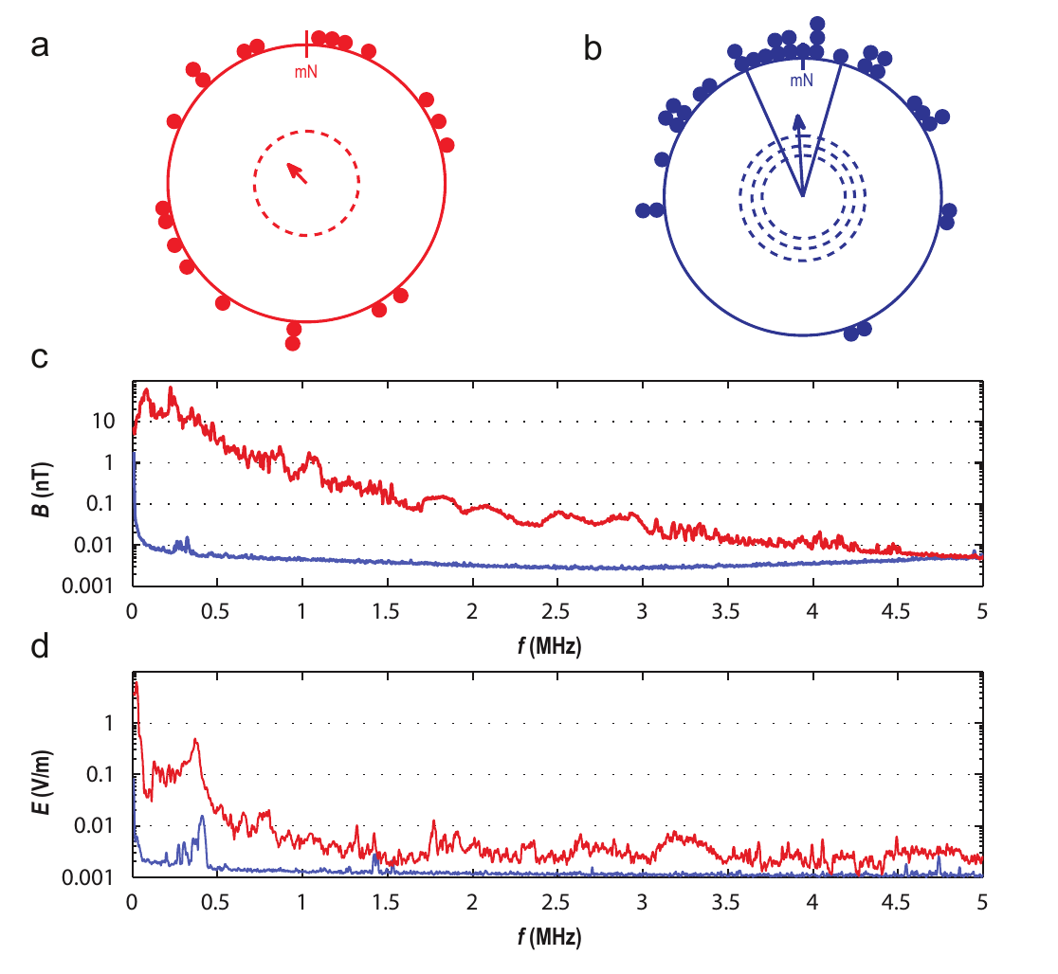
Electromagnetic shielding restores robin orientation
Engels and colleagues found that European robins in wooden huts on an urban campus failed to express their expected migratory direction. They added electrically connected, grounded aluminum screening to reduce ambient electromagnetic noise while leaving the static Earth field available.
The screening attenuated noise from about 50 kHz to at least 20 MHz by roughly two orders of magnitude. Birds then recovered seasonal magnetic orientation. Reported ambient noise had peak magnetic intensities of approximately 0.1–50 nT at individual frequencies, much smaller than the local static field of about 49,000 nT.
The intervention linked orientation performance to the electromagnetic environment. Screening alone changes more than one potential environmental variable, so the authors followed it with grounding and deliberate-noise controls. Grounding the screens and adding deliberate noise then test whether electromagnetic noise is the variable responsible.
Engels et al. (2014), Fig. 1(a–d). Shielding restores robin orientation and reduces electromagnetic noise.
Engels et al. (2014)
32
Notes:
• Engels and colleagues found that European robins in wooden huts on an urban campus failed to express their expected migratory direction. They added electrically connected, grounded aluminum screening to reduce ambient electromagnetic noise while leaving the static Earth field available.
– A static field remains approximately constant in time, whereas radiofrequency noise oscillates rapidly. The weak oscillating exposure can interfere with a sensory process even though its amplitude is far smaller than the static field that normally supplies compass information.
• The screening attenuated noise from about 50 kHz to at least 20 MHz by roughly two orders of magnitude. Birds then recovered seasonal magnetic orientation. Reported ambient noise had peak magnetic intensities of approximately 0.1–50 nT at individual frequencies, much smaller than the local static field of about 49,000 nT.
• The intervention linked orientation performance to the electromagnetic environment. Screening alone changes more than one potential environmental variable, so the authors followed it with grounding and deliberate-noise controls. Grounding the screens and adding deliberate noise then test whether electromagnetic noise is the variable responsible.
References:
Engels S, Schneider NL, Lefeldt N, Hein CM, Zapka M, Michalik A, Elbers D, Kittel A, Hore PJ, Mouritsen H (2014). Anthropogenic electromagnetic noise disrupts magnetic compass orientation in a migratory bird. Nature 509(7500):353-356. https://doi.org/10.1038/nature13290
Figure: Engels et al. (2014), Fig. 1(a–d). Shielding restores robin orientation and reduces electromagnetic noise.
Figure source: https://doi.org/10.1038/nature13290

Slide 44
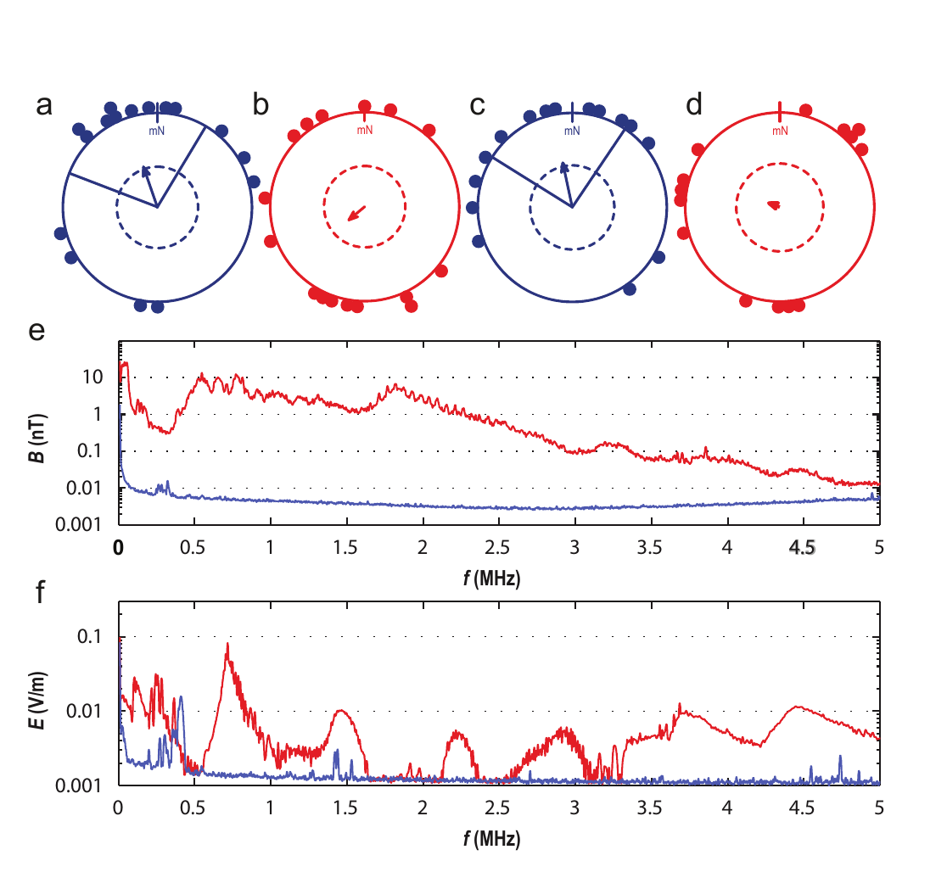
Grounding reversibly changes the shielding effect
The aluminum screens lost much of their protective effect when disconnected from electrical ground. Engels and colleagues alternated tests of the same birds between grounded and ungrounded screened huts, while the experimenters evaluating orientation were unaware which hut carried which electrical condition.
Birds oriented toward their spring migratory direction in grounded huts but lacked a consistent direction in ungrounded huts. The accompanying field measurements documented the difference in electromagnetic noise rather than treating the presence of metal screening alone as a sufficient control.
The reversible manipulation strengthens the causal association between the screened electromagnetic environment and compass performance. Field measurements documented the difference in electromagnetic noise between grounded and ungrounded huts, which links the change in orientation to the electromagnetic environment.
Engels et al. (2014), Fig. 2(a–f). Grounding controls the effect of shielding on orientation.
Engels et al. (2014)
33
Notes:
• The aluminum screens lost much of their protective effect when disconnected from electrical ground. Engels and colleagues alternated tests of the same birds between grounded and ungrounded screened huts, while the experimenters evaluating orientation were unaware which hut carried which electrical condition.
– Grounding connects conductive screening to an electrical reference so that its effect on noise differs from an isolated metal enclosure. The behavioral comparison is tied to measured exposure conditions, not merely to the nominal construction of the huts.
• Birds oriented toward their spring migratory direction in grounded huts but lacked a consistent direction in ungrounded huts. The accompanying field measurements documented the difference in electromagnetic noise rather than treating the presence of metal screening alone as a sufficient control.
• The reversible manipulation strengthens the causal association between the screened electromagnetic environment and compass performance. Field measurements documented the difference in electromagnetic noise between grounded and ungrounded huts, which links the change in orientation to the electromagnetic environment.
References:
Engels S, Schneider NL, Lefeldt N, Hein CM, Zapka M, Michalik A, Elbers D, Kittel A, Hore PJ, Mouritsen H (2014). Anthropogenic electromagnetic noise disrupts magnetic compass orientation in a migratory bird. Nature 509(7500):353-356. https://doi.org/10.1038/nature13290
Figure: Engels et al. (2014), Fig. 2(a–f). Grounding controls the effect of shielding on orientation.
Figure source: https://doi.org/10.1038/nature13290

Slide 45
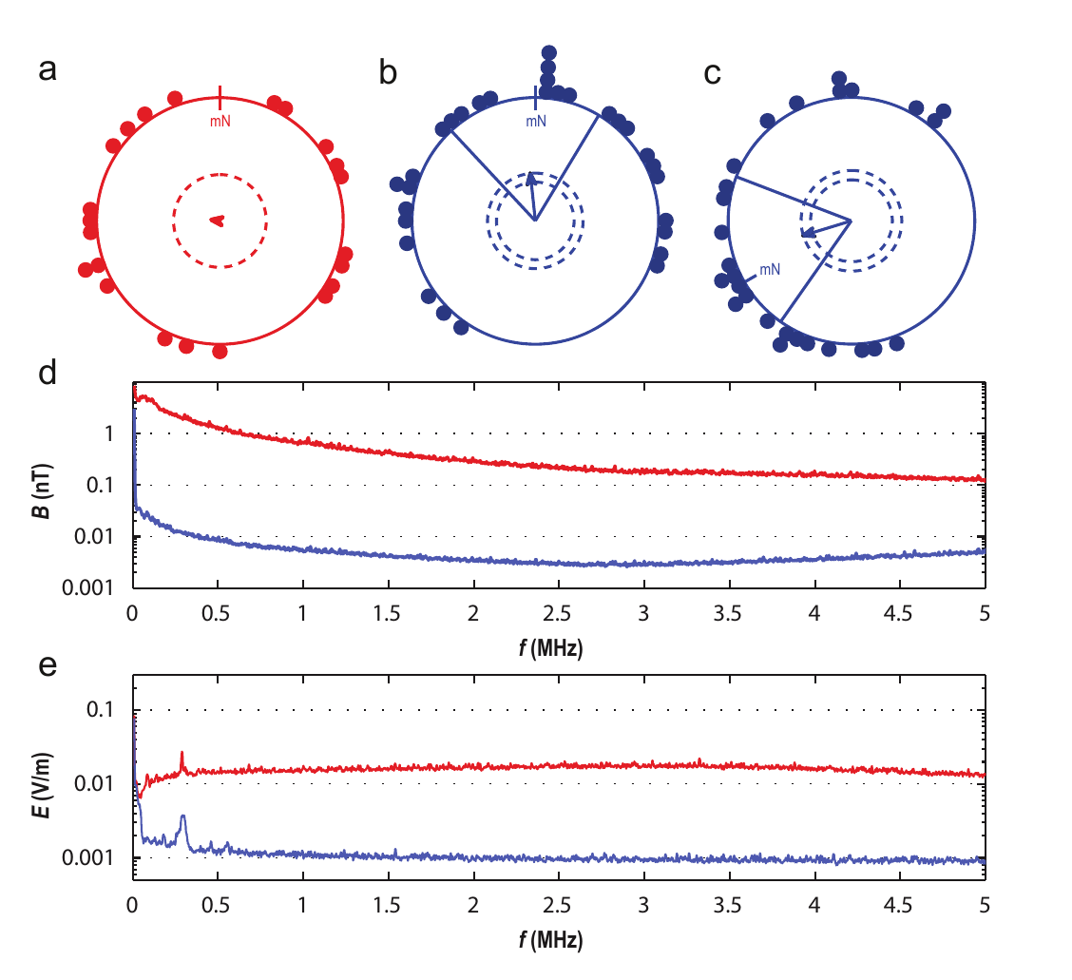
Reintroduced noise disrupts the recovered compass
Inside grounded screened huts, investigators deliberately introduced broadband electromagnetic noise from approximately 2 kHz to 9 MHz. Robins again became disoriented. The treatment therefore recreated the behavioral deficit in a preparation that otherwise supported normal magnetic orientation.
With the same electronics present but generator output reduced to its minimum, birds recovered their seasonal direction and responded to a 120° anticlockwise rotation of the static field. Separate bands near 20–450 kHz and 600 kHz–3 MHz also interfered with orientation in further tests.
The controls make the mere presence of a generator an inadequate explanation. The effects support an electromagnetic sensitivity relevant to compass processing, and independent molecular and anatomical tests evaluate the candidate radical-pair mechanism.
Engels et al. (2014), Fig. 3(a–e). Reintroduced broadband noise disrupts magnetic orientation.
Engels et al. (2014)
34
Notes:
• Inside grounded screened huts, investigators deliberately introduced broadband electromagnetic noise from approximately 2 kHz to 9 MHz. Robins again became disoriented. The treatment therefore recreated the behavioral deficit in a preparation that otherwise supported normal magnetic orientation.
– The study measured behavioral direction and exposure spectra. It did not record a retinal ion channel or magnetic-sensitive neuron, so radiofrequency susceptibility constrains possible mechanisms without completing the transduction pathway.
• With the same electronics present but generator output reduced to its minimum, birds recovered their seasonal direction and responded to a 120° anticlockwise rotation of the static field. Separate bands near 20–450 kHz and 600 kHz–3 MHz also interfered with orientation in further tests.
• The controls make the mere presence of a generator an inadequate explanation. The effects support an electromagnetic sensitivity relevant to compass processing, and independent molecular and anatomical tests evaluate the candidate radical-pair mechanism.
References:
Engels S, Schneider NL, Lefeldt N, Hein CM, Zapka M, Michalik A, Elbers D, Kittel A, Hore PJ, Mouritsen H (2014). Anthropogenic electromagnetic noise disrupts magnetic compass orientation in a migratory bird. Nature 509(7500):353-356. https://doi.org/10.1038/nature13290
Figure: Engels et al. (2014), Fig. 3(a–e). Reintroduced broadband noise disrupts magnetic orientation.
Figure source: https://doi.org/10.1038/nature13290

Slide 46
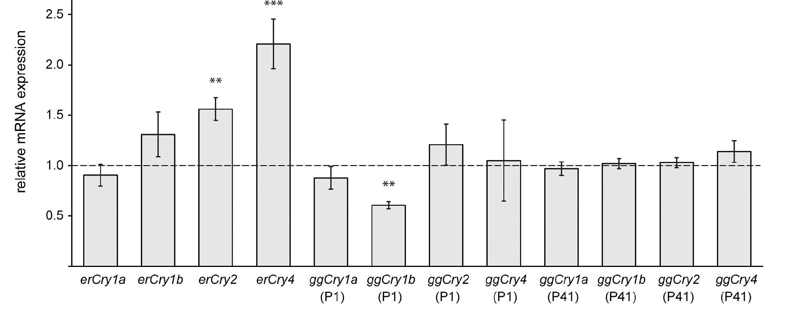
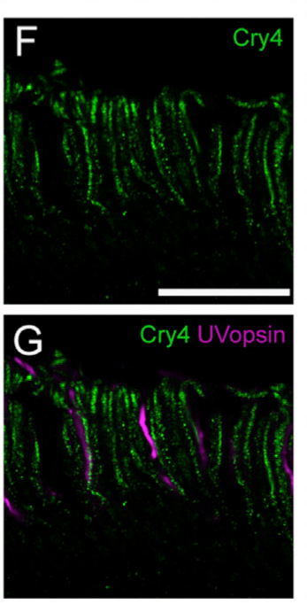
Retinal Cry4 expression varies with migratory season
Cryptochromes are flavoproteins, proteins containing a flavin cofactor, related to photolyases, proteins involved in light-dependent DNA repair. Günther and colleagues compared retinal cryptochrome messenger RNA, the transcript used to produce protein, across migratory and non-migratory seasons in European robins and domestic chickens.
Cry4 transcript abundance increased during spring and autumn migratory seasons in robins, whereas the same migratory-season increase was not observed in chickens. The study also measured 24-h expression profiles: Cry1 and Cry2 varied more strongly over the day than Cry4, which exhibited relatively weak circadian variation.
The expression pattern makes Cry4 a candidate relevant to nocturnal navigation rather than solely a strongly rhythmic clock transcript. Seasonal expression of Cry4 correlates with the migratory period, which makes it a candidate for a role in nocturnal navigation.
Günther et al. (2018), Fig. 2. Cry4 expression differs between migratory and non-migratory seasons.
Günther et al. (2018), Fig. 4(F–G). Magnified outer segments compare Cry4 with ultraviolet opsin staining.
Günther et al. (2018)
35
Notes:
• Cryptochromes are flavoproteins, proteins containing a flavin cofactor, related to photolyases, proteins involved in light-dependent DNA repair. Günther and colleagues compared retinal cryptochrome messenger RNA, the transcript used to produce protein, across migratory and non-migratory seasons in European robins and domestic chickens.
– A circadian pattern is a roughly daily rhythm. A protein available across the night is compatible with a sensory role, but the expression experiment alone cannot separate that role from other physiological functions associated with the migratory season.
• Cry4 transcript abundance increased during spring and autumn migratory seasons in robins, whereas the same migratory-season increase was not observed in chickens. The study also measured 24-h expression profiles: Cry1 and Cry2 varied more strongly over the day than Cry4, which exhibited relatively weak circadian variation.
• The expression pattern makes Cry4 a candidate relevant to nocturnal navigation rather than solely a strongly rhythmic clock transcript. Seasonal expression of Cry4 correlates with the migratory period, which makes it a candidate for a role in nocturnal navigation.
References:
Günther A, Einwich A, Sjulstok E, Feederle R, Bolte P, Koch KW, Solov’yov IA, Mouritsen H (2018). Double-Cone Localization and Seasonal Expression Pattern Suggest a Role in Magnetoreception for European Robin Cryptochrome 4. Current Biology 28(2):211-223.e4. https://doi.org/10.1016/j.cub.2017.12.003
Figure: Günther et al. (2018), Fig. 2. Cry4 expression differs between migratory and non-migratory seasons.
Figure source: https://doi.org/10.1016/j.cub.2017.12.003
Figure: Günther et al. (2018), Fig. 4(F–G). Magnified outer segments compare Cry4 with ultraviolet opsin staining.
Figure source: https://doi.org/10.1016/j.cub.2017.12.003

Slide 47
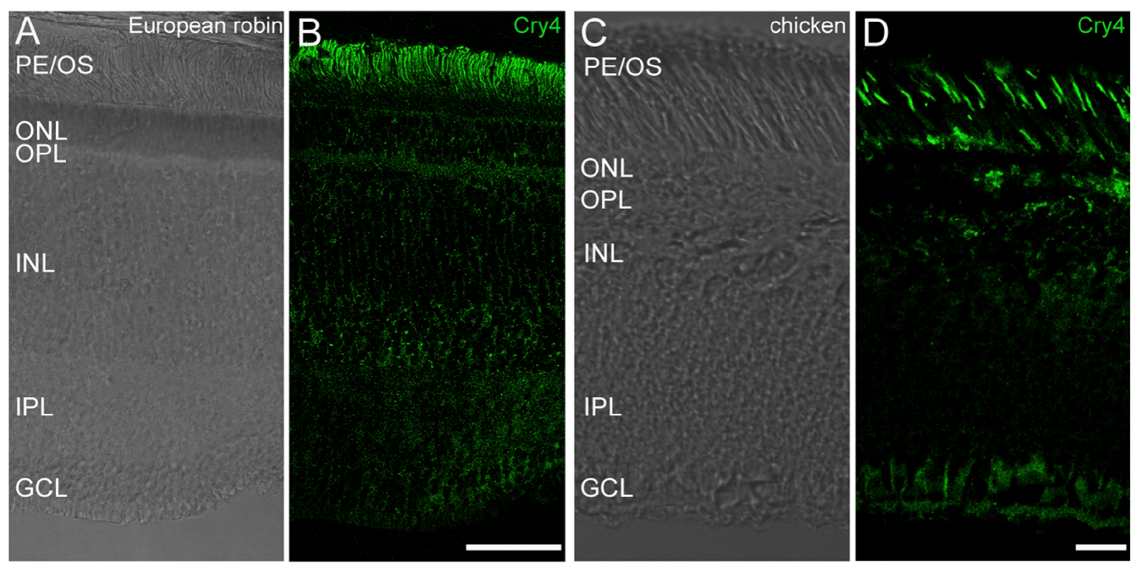
Cry4 staining localizes to photoreceptor outer segments
The retina contains light-sensitive photoreceptors, including cones and rods. A photoreceptor’s outer segment is the specialized compartment containing light-sensitive membrane structures. Günther and colleagues used immunohistochemistry, antibody-based protein localization, to examine where Cry4 occurs in robin retinal tissue.
Cry4 immunoreactivity was concentrated in photoreceptor outer segments and appeared across peripheral and central retinal regions. The authors compared the staining pattern in robins and chickens and used both monoclonal and polyclonal reagents rather than relying on one antibody preparation.
Localization places the candidate protein in photoreceptor outer segments, a tissue compatible with a visually mediated magnetic process. The staining pattern was examined in robins and chickens with both monoclonal and polyclonal reagents.
Günther et al. (2018), Fig. 3(A–D). Cry4 staining is concentrated in photoreceptor outer segments.
Günther et al. (2018), Fig. 4(F–G). Magnified outer segments compare Cry4 with ultraviolet opsin staining.
Günther et al. (2018)
36
Notes:
• The retina contains light-sensitive photoreceptors, including cones and rods. A photoreceptor’s outer segment is the specialized compartment containing light-sensitive membrane structures. Günther and colleagues used immunohistochemistry, antibody-based protein localization, to examine where Cry4 occurs in robin retinal tissue.
– Monoclonal antibodies recognize a selected antigenic target, whereas polyclonal preparations include several antibody populations. Agreement between independent reagents helps constrain a localization claim, provided that their specificity is tested rather than assumed.
• Cry4 immunoreactivity was concentrated in photoreceptor outer segments and appeared across peripheral and central retinal regions. The authors compared the staining pattern in robins and chickens and used both monoclonal and polyclonal reagents rather than relying on one antibody preparation.
• Localization places the candidate protein in photoreceptor outer segments, a tissue compatible with a visually mediated magnetic process. The staining pattern was examined in robins and chickens with both monoclonal and polyclonal reagents.
References:
Günther A, Einwich A, Sjulstok E, Feederle R, Bolte P, Koch KW, Solov’yov IA, Mouritsen H (2018). Double-Cone Localization and Seasonal Expression Pattern Suggest a Role in Magnetoreception for European Robin Cryptochrome 4. Current Biology 28(2):211-223.e4. https://doi.org/10.1016/j.cub.2017.12.003
Figure: Günther et al. (2018), Fig. 3(A–D). Cry4 staining is concentrated in photoreceptor outer segments.
Figure source: https://doi.org/10.1016/j.cub.2017.12.003
Figure: Günther et al. (2018), Fig. 4(F–G). Magnified outer segments compare Cry4 with ultraviolet opsin staining.
Figure source: https://doi.org/10.1016/j.cub.2017.12.003

Slide 48
Immunohistochemistry localizes a protein in tissue
Immunohistochemistry uses antibodies to label a protein in tissue sections. A fluorescent signal marks where the antibody found its target, so the method reveals which cells and compartments contain the protein. The antibodies bind to the protein only where it occurs in the tissue.
Günther and colleagues applied antibodies against Cry4 to robin retina. Cry4 immunoreactivity was concentrated in photoreceptor outer segments and appeared across peripheral and central regions, and the pattern was compared in robins and chickens with monoclonal and polyclonal reagents.
An outer segment is the compartment of a photoreceptor that contains the light-sensitive membrane. A candidate magnetic protein located there lies in a position compatible with a process that depends on light. The localization is consistent with a role in a light-dependent process in the retina.
Günther et al. (2018), Fig. 3(A–D). Cry4 staining is concentrated in photoreceptor outer segments.
Günther et al. (2018), Fig. 4(F–G). Magnified outer segments compare Cry4 with ultraviolet opsin staining.
Günther et al. (2018)
36a
Notes:
• Antibody labeling shows where a protein is located in a tissue.
• Method.
– Antibodies bind to a specific protein in a tissue section.
– A fluorescent label marks the bound antibody.
• The retina.
– The retina contains light-sensitive photoreceptors, including cones and rods.
• Outer segments.
– The outer segment is the specialized compartment that contains light-sensitive membrane structures.
• Result.
– Cry4 immunoreactivity was concentrated in outer segments.
– It appeared across peripheral and central retinal regions.
• Reagents.
– Monoclonal and polyclonal reagents were both used, so the result does not rest on one antibody.
• Species comparison.
– The pattern was compared in robins and chickens.
• Controls for the antibody.
– Using different kinds of antibody reagents reduces the chance that the pattern comes from one preparation.
– The staining was compared with chicken retina.
• Where light is detected.
– Light-sensitive membrane structures sit in the outer segment, which makes it the site of the first steps of vision.
– A protein in this compartment is positioned to be exposed to light.
References:
Günther A, Einwich A, Sjulstok E, Feederle R, Bolte P, Koch KW, Solov’yov IA, Mouritsen H (2018). Double-Cone Localization and Seasonal Expression Pattern Suggest a Role in Magnetoreception for European Robin Cryptochrome 4. Current Biology 28(2):211-223.e4. https://doi.org/10.1016/j.cub.2017.12.003

Slide 49
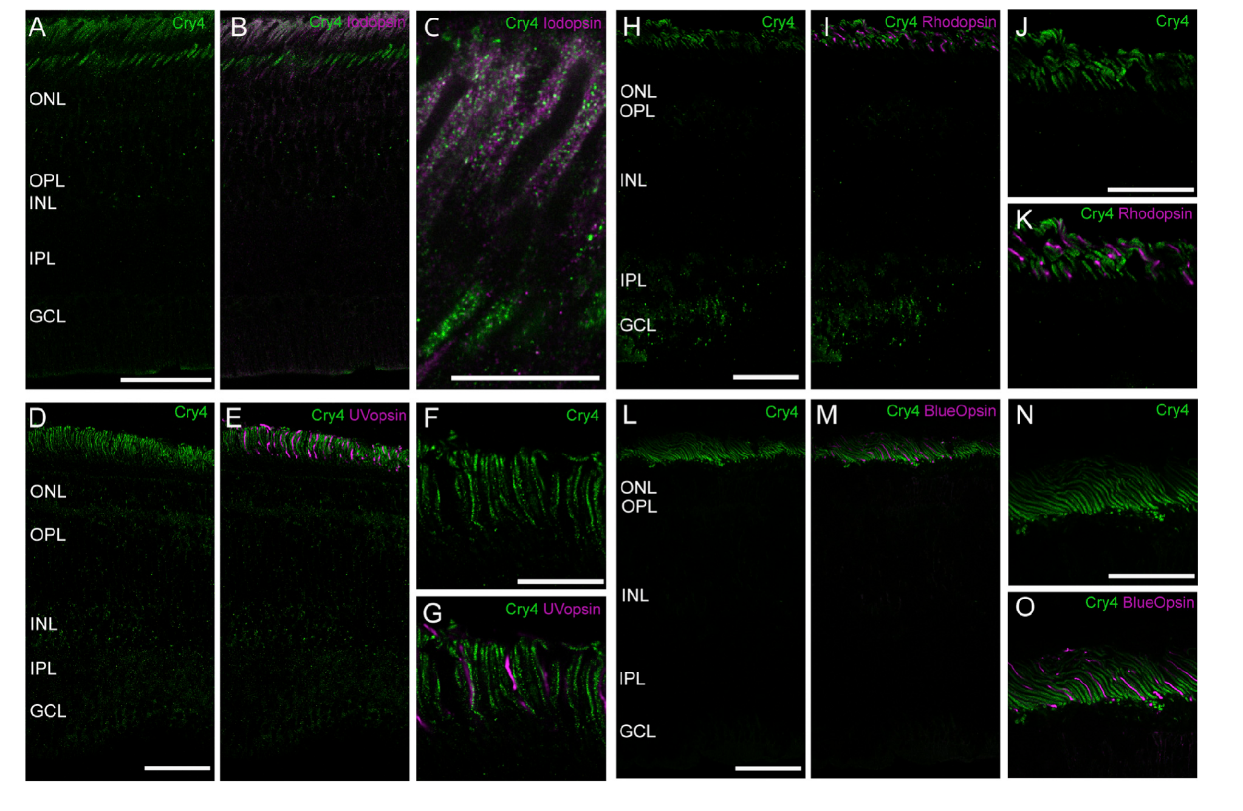
Double staining identifies Cry4-positive cone classes
Opsins are light-sensitive receptor proteins that help distinguish photoreceptor classes. The study combined Cry4 staining with antibodies to iodopsin, ultraviolet opsin, blue opsin and rhodopsin. Double staining tests whether two molecular labels occupy the same cellular compartment rather than merely nearby tissue.
Cry4 signal overlapped iodopsin-positive outer segments, associated with long-wavelength single cones and double cones. It did not overlap the outer segments labeled by ultraviolet opsin, blue opsin or rhodopsin. Additional calbindin staining identified inner segments of double cones and supported the assignment of Cry4 to these cone classes.
Cry4 overlapped iodopsin-positive outer segments, which narrows the candidate cellular location to long-wavelength single cones and double cones. Ordinary photoreceptor identity and a hypothesized magnetic role are separate properties that experiments on function address.
Günther et al. (2018), Fig. 4(A–O). Double staining identifies the Cry4-positive cone classes.
Günther et al. (2018)
37
Notes:
• Opsins are light-sensitive receptor proteins that help distinguish photoreceptor classes. The study combined Cry4 staining with antibodies to iodopsin, ultraviolet opsin, blue opsin and rhodopsin. Double staining tests whether two molecular labels occupy the same cellular compartment rather than merely nearby tissue.
– Rhodopsin identifies rod photoreceptors in these comparisons. The absence of overlapping Cry4 signal in rod outer segments is a localization result, not proof that rods or other retinal cells are irrelevant to every stage of magnetic compass behavior.
• Cry4 signal overlapped iodopsin-positive outer segments, associated with long-wavelength single cones and double cones. It did not overlap the outer segments labeled by ultraviolet opsin, blue opsin or rhodopsin. Additional calbindin staining identified inner segments of double cones and supported the assignment of Cry4 to these cone classes.
• Cry4 overlapped iodopsin-positive outer segments, which narrows the candidate cellular location to long-wavelength single cones and double cones. Ordinary photoreceptor identity and a hypothesized magnetic role are separate properties that experiments on function address.
References:
Günther A, Einwich A, Sjulstok E, Feederle R, Bolte P, Koch KW, Solov’yov IA, Mouritsen H (2018). Double-Cone Localization and Seasonal Expression Pattern Suggest a Role in Magnetoreception for European Robin Cryptochrome 4. Current Biology 28(2):211-223.e4. https://doi.org/10.1016/j.cub.2017.12.003
Figure: Günther et al. (2018), Fig. 4(A–O). Double staining identifies the Cry4-positive cone classes.
Figure source: https://doi.org/10.1016/j.cub.2017.12.003

Slide 50
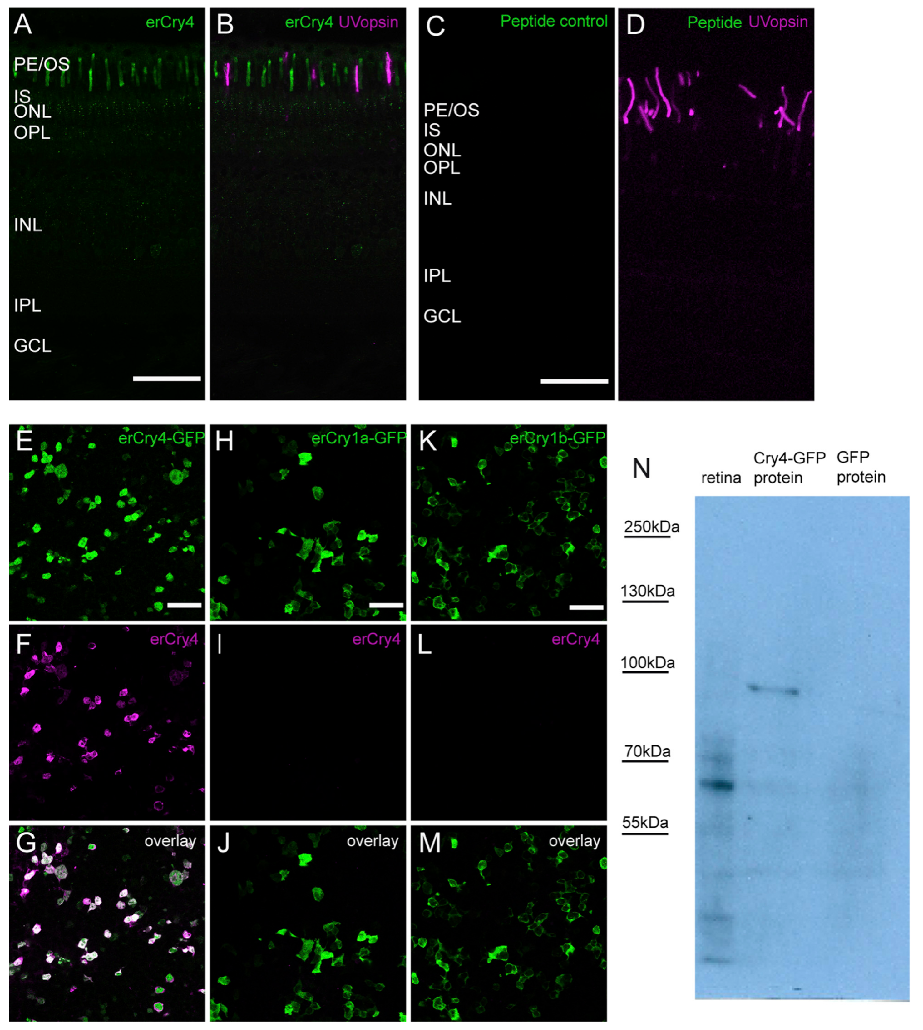
Antibody controls constrain the localization claim
Günther and colleagues tested antibody specificity by replacing the primary antibody with pre-immune serum, absorbing it with its antigenic peptide, and expressing different cryptochromes in cultured cells. These controls address background staining and cross-reaction with related proteins rather than treating any fluorescent signal as Cry4.
Western blots detected an approximately 61-kDa retinal protein and an approximately 89-kDa Cry4–GFP fusion protein in the expression preparation. GFP is green fluorescent protein used as a molecular tag. Cry4 antibody did not produce the corresponding signal in control cells expressing other tested cryptochromes or GFP alone.
The controls support identification of the stained protein and strengthen the anatomical result. Reliable molecular localization is a prerequisite for a receptor hypothesis, and the antibody controls make the staining specific for Cry4.
Günther et al. (2018), Fig. 6(A–N). Antibody controls test Cry4 localization and specificity.
Günther et al. (2018)
38
Notes:
• Günther and colleagues tested antibody specificity by replacing the primary antibody with pre-immune serum, absorbing it with its antigenic peptide, and expressing different cryptochromes in cultured cells. These controls address background staining and cross-reaction with related proteins rather than treating any fluorescent signal as Cry4.
– Antigenic-peptide absorption tests whether the staining depends on recognition of the antibody’s intended target sequence. A loss of signal after that control is useful evidence of specificity, while independent cell-expression controls address recognition of related proteins.
• Western blots detected an approximately 61-kDa retinal protein and an approximately 89-kDa Cry4–GFP fusion protein in the expression preparation. GFP is green fluorescent protein used as a molecular tag. Cry4 antibody did not produce the corresponding signal in control cells expressing other tested cryptochromes or GFP alone.
• The controls support identification of the stained protein and strengthen the anatomical result. Reliable molecular localization is a prerequisite for a receptor hypothesis, and the antibody controls make the staining specific for Cry4.
References:
Günther A, Einwich A, Sjulstok E, Feederle R, Bolte P, Koch KW, Solov’yov IA, Mouritsen H (2018). Double-Cone Localization and Seasonal Expression Pattern Suggest a Role in Magnetoreception for European Robin Cryptochrome 4. Current Biology 28(2):211-223.e4. https://doi.org/10.1016/j.cub.2017.12.003
Figure: Günther et al. (2018), Fig. 6(A–N). Antibody controls test Cry4 localization and specificity.
Figure source: https://doi.org/10.1016/j.cub.2017.12.003

Slide 51
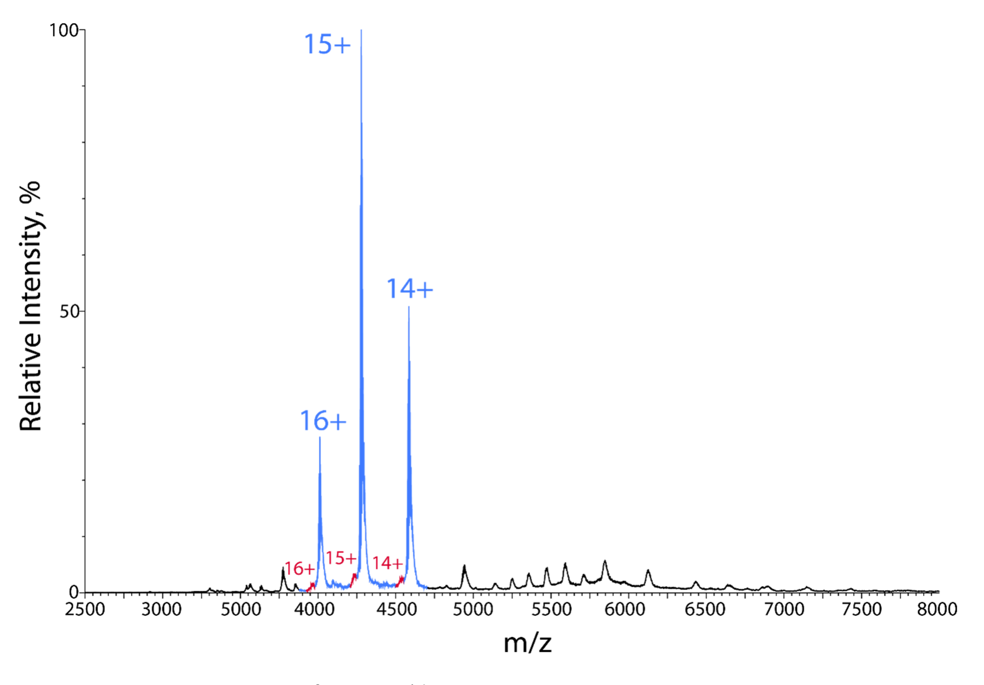
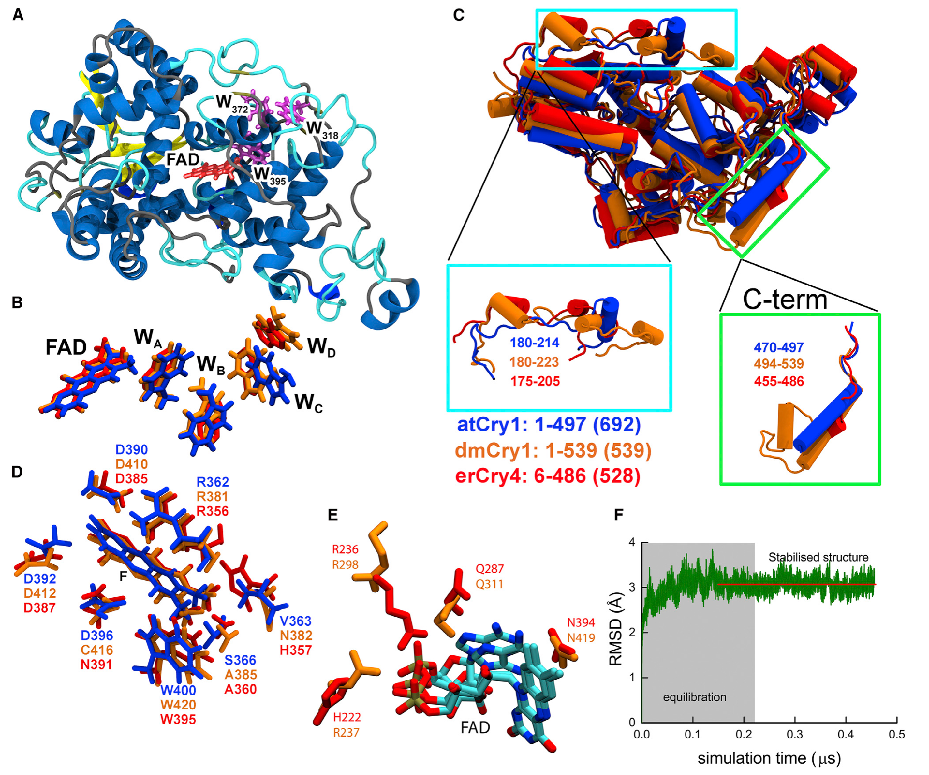
Purified Cry4 binds the FAD cofactor
Xu and colleagues expressed and purified European robin Cry4 to test its photochemistry directly. Flavin adenine dinucleotide, or FAD, is the bound light-absorbing cofactor that can participate in electron transfer. A cofactor is a nonprotein component needed for a protein’s chemical function.
Optical spectroscopy and native mass spectrometry indicated that more than 97% of the purified wild-type Cry4 population carried FAD. The supplementary spectrum separated major FAD-bound protein peaks from minor peaks assigned to protein lacking the cofactor. This preparation supplied a controlled molecular system independent of an intact animal.
FAD binding establishes that the purified candidate possesses the component required for the studied radical-pair chemistry. The published structural model places FAD near a chain of tryptophan residues. Cry4 therefore has the cofactor and the electron-transfer chain on which the radical-pair mechanism depends.
Xu et al. (2021), Supplementary Fig. S13. Mass spectra identify FAD-bound cryptochrome 4.
Günther et al. (2018), Fig. 7(A–F). Published Cry4 structural model and FAD-binding region.
Xu et al. (2021); Günther et al. (2018)
39
Notes:
• Xu and colleagues expressed and purified European robin Cry4 to test its photochemistry directly. Flavin adenine dinucleotide, or FAD, is the bound light-absorbing cofactor that can participate in electron transfer. A cofactor is a nonprotein component needed for a protein’s chemical function.
– The structural image is the authors’ published model, not an experimentally solved robin Cry4 structure. Its role is to represent a proposed molecular arrangement; spectroscopy and mass measurements provide the experimental evidence for the purified preparation.
• Optical spectroscopy and native mass spectrometry indicated that more than 97% of the purified wild-type Cry4 population carried FAD. The supplementary spectrum separated major FAD-bound protein peaks from minor peaks assigned to protein lacking the cofactor. This preparation supplied a controlled molecular system independent of an intact animal.
• FAD binding establishes that the purified candidate possesses the component required for the studied radical-pair chemistry. The published structural model places FAD near a chain of tryptophan residues. Cry4 therefore has the cofactor and the electron-transfer chain on which the radical-pair mechanism depends.
References:
Xu J, Jarocha LE, Zollitsch T, Konowalczyk M, Henbest KB, Richert S, Golesworthy MJ, Schmidt J, Déjean V, Sowood DJC, Bassetto M, Luo J, Walton JR, Fleming J, Wei Y, Pitcher TL, Moise G, Herrmann M, Yin H, Wu H, Bartölke R, Käsehagen SJ, Horst S, Dautaj G, Murton PDF, Gehrckens AS, Chelliah Y, Takahashi JS, Koch KW, Weber S, Solov’yov IA, Xie C, Mackenzie SR, Timmel CR, Mouritsen H, Hore PJ (2021). Magnetic sensitivity of cryptochrome 4 from a migratory songbird. Nature 594(7864):535-540. https://doi.org/10.1038/s41586-021-03618-9
Günther A, Einwich A, Sjulstok E, Feederle R, Bolte P, Koch KW, Solov’yov IA, Mouritsen H (2018). Double-Cone Localization and Seasonal Expression Pattern Suggest a Role in Magnetoreception for European Robin Cryptochrome 4. Current Biology 28(2):211-223.e4. https://doi.org/10.1016/j.cub.2017.12.003
Figure: Xu et al. (2021), Supplementary Fig. S13. Mass spectra identify FAD-bound cryptochrome 4.
Figure source: https://doi.org/10.1038/s41586-021-03618-9
Figure: Günther et al. (2018), Fig. 7(A–F). Published Cry4 structural model and FAD-binding region.
Figure source: https://doi.org/10.1016/j.cub.2017.12.003

Slide 52
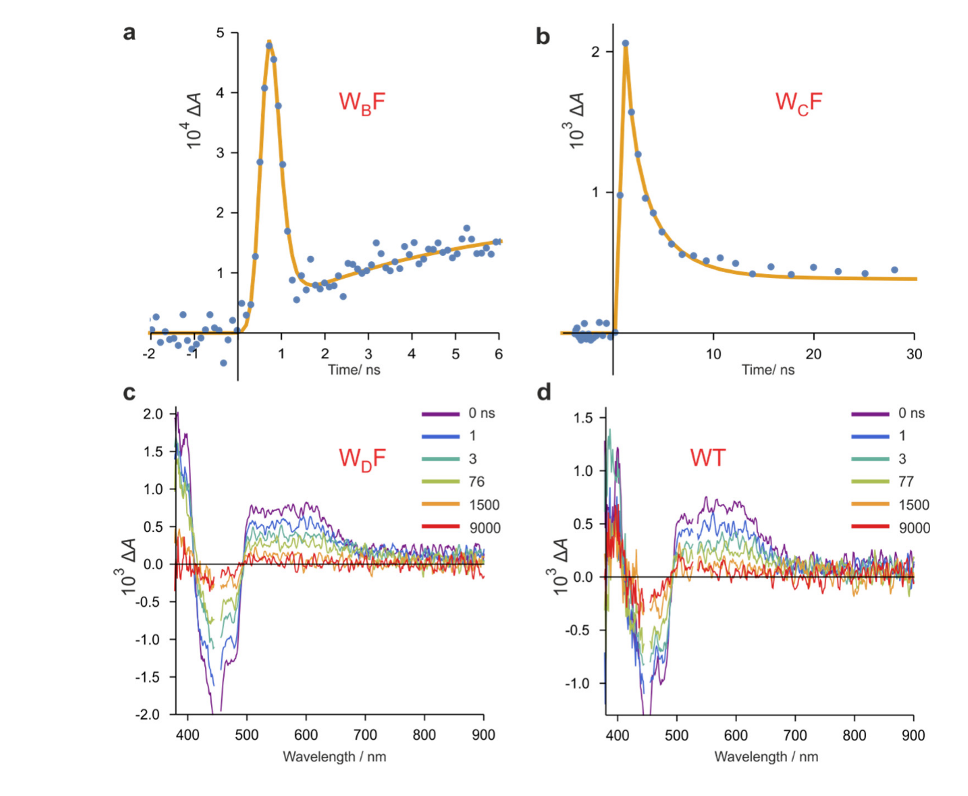
Tryptophan mutations change radical-pair lifetimes
A radical is a molecular species with an unpaired electron; a radical pair contains two radicals generated through a linked reaction. In Cry4, light-excited FAD can receive an electron through a chain of tryptophan residues, producing radicals whose subsequent reactions depend on their electronic states.
Xu and colleagues replaced individual tryptophans with redox-inactive phenylalanine. Redox refers to electron-transfer chemistry. After 450-nm excitation, transient absorption measurements tracked changes over time. In the supplementary measurements, interrupted early transfer pathways produced radical-loss time constants of 180 ps and 900 ps.
Longer transfer pathways supported radicals persisting beyond the earliest nanosecond responses. The nearest-tryptophan mutation prevented the normal radical production observed in the wild-type preparation. Particular tryptophan residues therefore determine how quickly radicals form and how long they persist.
Xu et al. (2021), Supplementary Fig. S2(a–d). Tryptophan mutations change radical kinetics and spectra.
Günther et al. (2018), Fig. 7(A–F). Published Cry4 structural model and FAD-binding region.
Xu et al. (2021); Günther et al. (2018)
40
Notes:
• A radical is a molecular species with an unpaired electron; a radical pair contains two radicals generated through a linked reaction. In Cry4, light-excited FAD can receive an electron through a chain of tryptophan residues, producing radicals whose subsequent reactions depend on their electronic states.
– The electron-transfer chain is a molecular pathway rather than a neural circuit. Changing radical lifetime alters the time available for magnetic interactions, but the experiment does not identify a neuronal membrane channel controlled by that chemistry.
• Xu and colleagues replaced individual tryptophans with redox-inactive phenylalanine. Redox refers to electron-transfer chemistry. After 450-nm excitation, transient absorption measurements tracked changes over time. In the supplementary measurements, interrupted early transfer pathways produced radical-loss time constants of 180 ps and 900 ps.
• Longer transfer pathways supported radicals persisting beyond the earliest nanosecond responses. The nearest-tryptophan mutation prevented the normal radical production observed in the wild-type preparation. Particular tryptophan residues therefore determine how quickly radicals form and how long they persist.
References:
Xu J, Jarocha LE, Zollitsch T, Konowalczyk M, Henbest KB, Richert S, Golesworthy MJ, Schmidt J, Déjean V, Sowood DJC, Bassetto M, Luo J, Walton JR, Fleming J, Wei Y, Pitcher TL, Moise G, Herrmann M, Yin H, Wu H, Bartölke R, Käsehagen SJ, Horst S, Dautaj G, Murton PDF, Gehrckens AS, Chelliah Y, Takahashi JS, Koch KW, Weber S, Solov’yov IA, Xie C, Mackenzie SR, Timmel CR, Mouritsen H, Hore PJ (2021). Magnetic sensitivity of cryptochrome 4 from a migratory songbird. Nature 594(7864):535-540. https://doi.org/10.1038/s41586-021-03618-9
Günther A, Einwich A, Sjulstok E, Feederle R, Bolte P, Koch KW, Solov’yov IA, Mouritsen H (2018). Double-Cone Localization and Seasonal Expression Pattern Suggest a Role in Magnetoreception for European Robin Cryptochrome 4. Current Biology 28(2):211-223.e4. https://doi.org/10.1016/j.cub.2017.12.003
Figure: Xu et al. (2021), Supplementary Fig. S2(a–d). Tryptophan mutations change radical kinetics and spectra.
Figure source: https://doi.org/10.1038/s41586-021-03618-9
Figure: Günther et al. (2018), Fig. 7(A–F). Published Cry4 structural model and FAD-binding region.
Figure source: https://doi.org/10.1016/j.cub.2017.12.003

Slide 53
A radical pair contains two unpaired electrons
A radical is a molecule with an unpaired electron, and a radical pair is two such molecules produced together by a reaction. The spins of the two electrons can be correlated in a singlet or a triplet state. The photochemistry was studied in purified protein, outside the animal.
In Cry4, light-excited FAD receives an electron through a chain of tryptophan residues, which produces a radical pair. Xu and colleagues replaced individual tryptophans with redox-inactive phenylalanine and followed changes in absorption after 450-nm excitation.
Interrupted early transfer pathways produced radical-loss time constants of 180 ps and 900 ps, and longer pathways supported radicals that persisted longer. The residues in the chain therefore set the lifetime of the radical pair. Mutating a single residue can change the rate of electron transfer.
Xu et al. (2021), Supplementary Fig. S2(a–d). Tryptophan mutations change radical kinetics and spectra.
Günther et al. (2018), Fig. 7(A–F). Published Cry4 structural model and FAD-binding region.
Xu et al. (2021)
40a
Notes:
• The chemistry of a radical pair depends on electron spin.
• Radicals.
– A radical has an unpaired electron.
– A radical pair contains two radicals generated through a linked reaction.
• In Cry4.
– Light-excited FAD receives an electron through a chain of tryptophan residues.
– This produces radicals whose reactions depend on their electronic states.
• Mutations.
– Individual tryptophans were replaced with redox-inactive phenylalanine.
– Redox refers to electron-transfer chemistry.
• Measurement.
– Transient absorption tracked changes over time after 450-nanometer excitation.
• Result.
– Interrupted early transfer pathways gave radical-loss time constants of 180 and 900 picoseconds.
• Longer pathways.
– Longer transfer pathways supported radicals that persisted beyond the earliest nanosecond responses.
• Time scales.
– A picosecond is one trillionth of a second.
– The measured time constants were 180 and 900 picoseconds.
• Role of the chain.
– The nearest tryptophan prevented the normal radical production when it was replaced.
– Longer pathways supported longer-lived radicals.
– Measurements used purified protein, so the chemistry is studied outside the animal.
References:
Xu J, Jarocha LE, Zollitsch T, Konowalczyk M, Henbest KB, Richert S, Golesworthy MJ, Schmidt J, Déjean V, Sowood DJC, Bassetto M, Luo J, Walton JR, Fleming J, Wei Y, Pitcher TL, Moise G, Herrmann M, Yin H, Wu H, Bartölke R, Käsehagen SJ, Horst S, Dautaj G, Murton PDF, Gehrckens AS, Chelliah Y, Takahashi JS, Koch KW, Weber S, Solov’yov IA, Xie C, Mackenzie SR, Timmel CR, Mouritsen H, Hore PJ (2021). Magnetic sensitivity of cryptochrome 4 from a migratory songbird. Nature 594(7864):535-540. https://doi.org/10.1038/s41586-021-03618-9
Günther A, Einwich A, Sjulstok E, Feederle R, Bolte P, Koch KW, Solov’yov IA, Mouritsen H (2018). Double-Cone Localization and Seasonal Expression Pattern Suggest a Role in Magnetoreception for European Robin Cryptochrome 4. Current Biology 28(2):211-223.e4. https://doi.org/10.1016/j.cub.2017.12.003

Slide 54
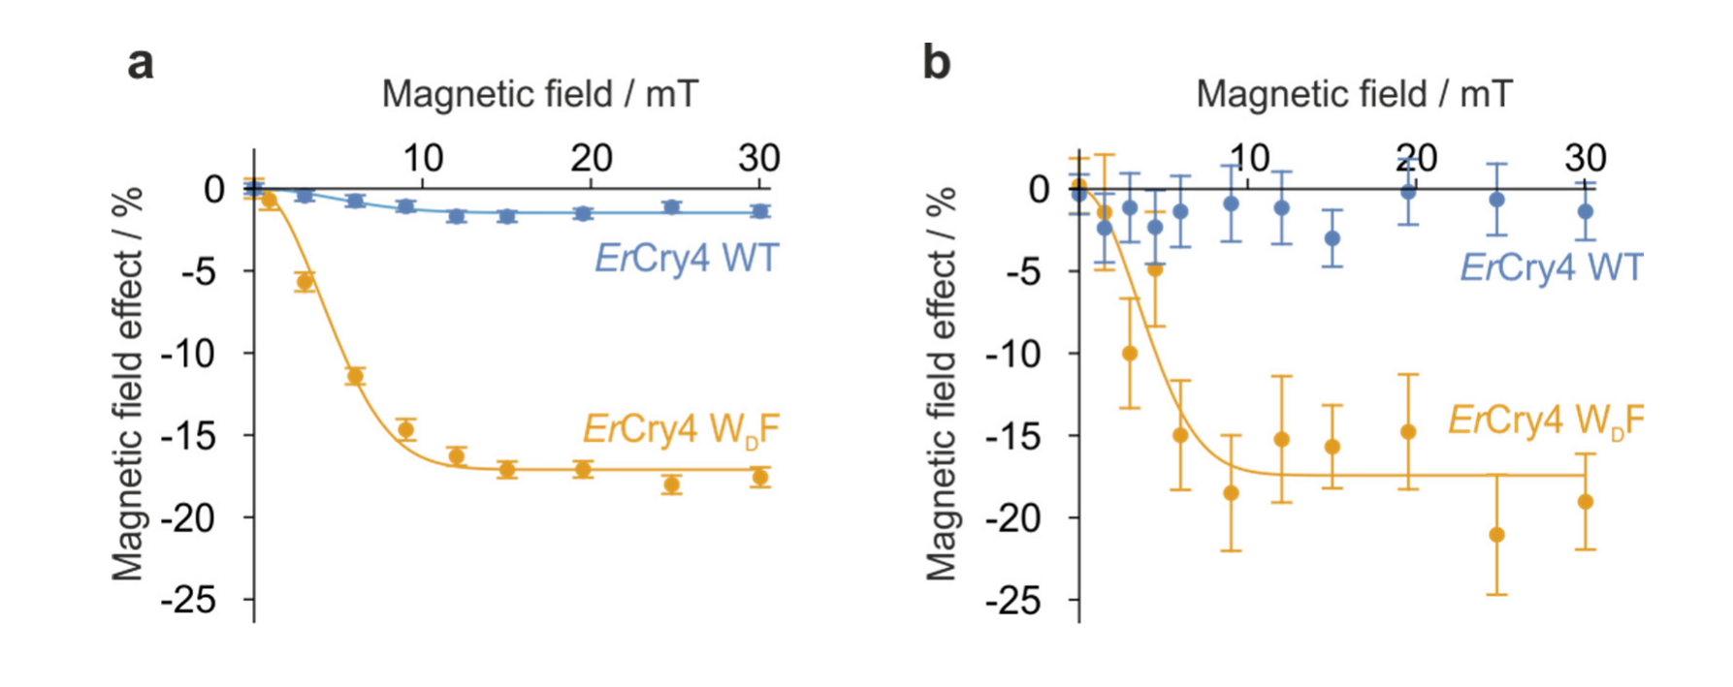
Cry4 radical chemistry responds to magnetic fields
Electron spin is a quantum property of an electron, not literal mechanical spinning. Spin-correlated radical pairs can occupy singlet and triplet states with different reaction possibilities. A magnetic field can alter transitions between these states and thereby influence the yield of chemical products.
Xu and colleagues measured field-dependent radical absorption in purified Cry4 after 450-nm excitation. The supplementary comparison covered fields up to 30 mT and tested wild-type protein against a tryptophan mutant. The mutant and wild type exhibited different magnetic field effects, connecting molecular structure to measured photochemical sensitivity.
The measurements establish magnetic sensitivity of the radical chemistry in vitro. Wild-type protein and the tryptophan mutant showed different magnetic field effects, which connects molecular structure to photochemical sensitivity under controlled temperature and chemical conditions.
Xu et al. (2021), Supplementary Fig. S3(a–b). Wild-type and mutant Cry4 have different magnetic field effects.
Günther et al. (2018), Fig. 7(A–F). Published Cry4 structural model and FAD-binding region.
Xu et al. (2021); Günther et al. (2018)
41
Notes:
• Electron spin is a quantum property of an electron, not literal mechanical spinning. Spin-correlated radical pairs can occupy singlet and triplet states with different reaction possibilities. A magnetic field can alter transitions between these states and thereby influence the yield of chemical products.
– Singlet and triplet describe different combined spin states of the two electrons. The proposed compass mechanism requires field direction to influence a biologically useful chemical signal; this experiment measures chemical sensitivity rather than a completed retinal-to-brain encoding pathway.
• Xu and colleagues measured field-dependent radical absorption in purified Cry4 after 450-nm excitation. The supplementary comparison covered fields up to 30 mT and tested wild-type protein against a tryptophan mutant. The mutant and wild type exhibited different magnetic field effects, connecting molecular structure to measured photochemical sensitivity.
• The measurements establish magnetic sensitivity of the radical chemistry in vitro. Wild-type protein and the tryptophan mutant showed different magnetic field effects, which connects molecular structure to photochemical sensitivity under controlled temperature and chemical conditions.
References:
Xu J, Jarocha LE, Zollitsch T, Konowalczyk M, Henbest KB, Richert S, Golesworthy MJ, Schmidt J, Déjean V, Sowood DJC, Bassetto M, Luo J, Walton JR, Fleming J, Wei Y, Pitcher TL, Moise G, Herrmann M, Yin H, Wu H, Bartölke R, Käsehagen SJ, Horst S, Dautaj G, Murton PDF, Gehrckens AS, Chelliah Y, Takahashi JS, Koch KW, Weber S, Solov’yov IA, Xie C, Mackenzie SR, Timmel CR, Mouritsen H, Hore PJ (2021). Magnetic sensitivity of cryptochrome 4 from a migratory songbird. Nature 594(7864):535-540. https://doi.org/10.1038/s41586-021-03618-9
Günther A, Einwich A, Sjulstok E, Feederle R, Bolte P, Koch KW, Solov’yov IA, Mouritsen H (2018). Double-Cone Localization and Seasonal Expression Pattern Suggest a Role in Magnetoreception for European Robin Cryptochrome 4. Current Biology 28(2):211-223.e4. https://doi.org/10.1016/j.cub.2017.12.003
Figure: Xu et al. (2021), Supplementary Fig. S3(a–b). Wild-type and mutant Cry4 have different magnetic field effects.
Figure source: https://doi.org/10.1038/s41586-021-03618-9
Figure: Günther et al. (2018), Fig. 7(A–F). Published Cry4 structural model and FAD-binding region.
Figure source: https://doi.org/10.1016/j.cub.2017.12.003

Slide 55
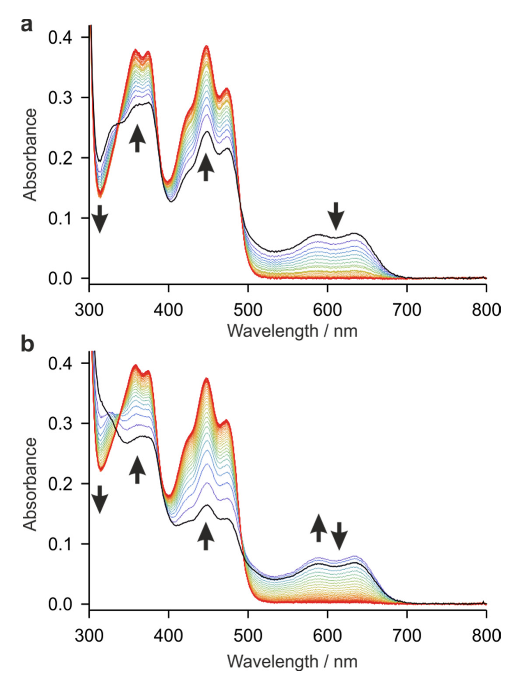
Photoreduced Cry4 can return toward its resting state
Photoreduction is light-driven electron gain. After illumination changes FAD’s oxidation state, a reusable sensory protein must return toward an appropriate starting state. Xu and colleagues measured optical spectra as photoreduced Cry4 reoxidized in contact with air without added redox reagents.
The supplementary experiment used 2 min of 450-nm illumination followed by spectra recorded at 2-min intervals. The main analysis reported recycling times of approximately 13 min from the neutral radical state toward oxidized FAD and approximately 1 min from the fully reduced state toward the neutral radical.
These measurements establish a route for chemical resetting under the tested conditions. Recycling of the protein toward its starting state supports its plausibility as a reusable sensor, with times of about 13 minutes and about 1 minute for the two steps.
Xu et al. (2021), Supplementary Fig. S15(a–b). Photoreduced Cry4 returns toward the oxidized state.
Günther et al. (2018), Fig. 7(A–F). Published Cry4 structural model and FAD-binding region.
Xu et al. (2021); Günther et al. (2018)
42
Notes:
• Photoreduction is light-driven electron gain. After illumination changes FAD’s oxidation state, a reusable sensory protein must return toward an appropriate starting state. Xu and colleagues measured optical spectra as photoreduced Cry4 reoxidized in contact with air without added redox reagents.
– A receptor cycle includes both activation and recovery. Demonstrating that the candidate can reset is different from demonstrating that its changing state is read by a neuron; the downstream signaling partner and membrane mechanism remain unresolved in these studies.
• The supplementary experiment used 2 min of 450-nm illumination followed by spectra recorded at 2-min intervals. The main analysis reported recycling times of approximately 13 min from the neutral radical state toward oxidized FAD and approximately 1 min from the fully reduced state toward the neutral radical.
• These measurements establish a route for chemical resetting under the tested conditions. Recycling of the protein toward its starting state supports its plausibility as a reusable sensor, with times of about 13 minutes and about 1 minute for the two steps.
References:
Xu J, Jarocha LE, Zollitsch T, Konowalczyk M, Henbest KB, Richert S, Golesworthy MJ, Schmidt J, Déjean V, Sowood DJC, Bassetto M, Luo J, Walton JR, Fleming J, Wei Y, Pitcher TL, Moise G, Herrmann M, Yin H, Wu H, Bartölke R, Käsehagen SJ, Horst S, Dautaj G, Murton PDF, Gehrckens AS, Chelliah Y, Takahashi JS, Koch KW, Weber S, Solov’yov IA, Xie C, Mackenzie SR, Timmel CR, Mouritsen H, Hore PJ (2021). Magnetic sensitivity of cryptochrome 4 from a migratory songbird. Nature 594(7864):535-540. https://doi.org/10.1038/s41586-021-03618-9
Günther A, Einwich A, Sjulstok E, Feederle R, Bolte P, Koch KW, Solov’yov IA, Mouritsen H (2018). Double-Cone Localization and Seasonal Expression Pattern Suggest a Role in Magnetoreception for European Robin Cryptochrome 4. Current Biology 28(2):211-223.e4. https://doi.org/10.1016/j.cub.2017.12.003
Figure: Xu et al. (2021), Supplementary Fig. S15(a–b). Photoreduced Cry4 returns toward the oxidized state.
Figure source: https://doi.org/10.1038/s41586-021-03618-9
Figure: Günther et al. (2018), Fig. 7(A–F). Published Cry4 structural model and FAD-binding region.
Figure source: https://doi.org/10.1016/j.cub.2017.12.003

Slide 56
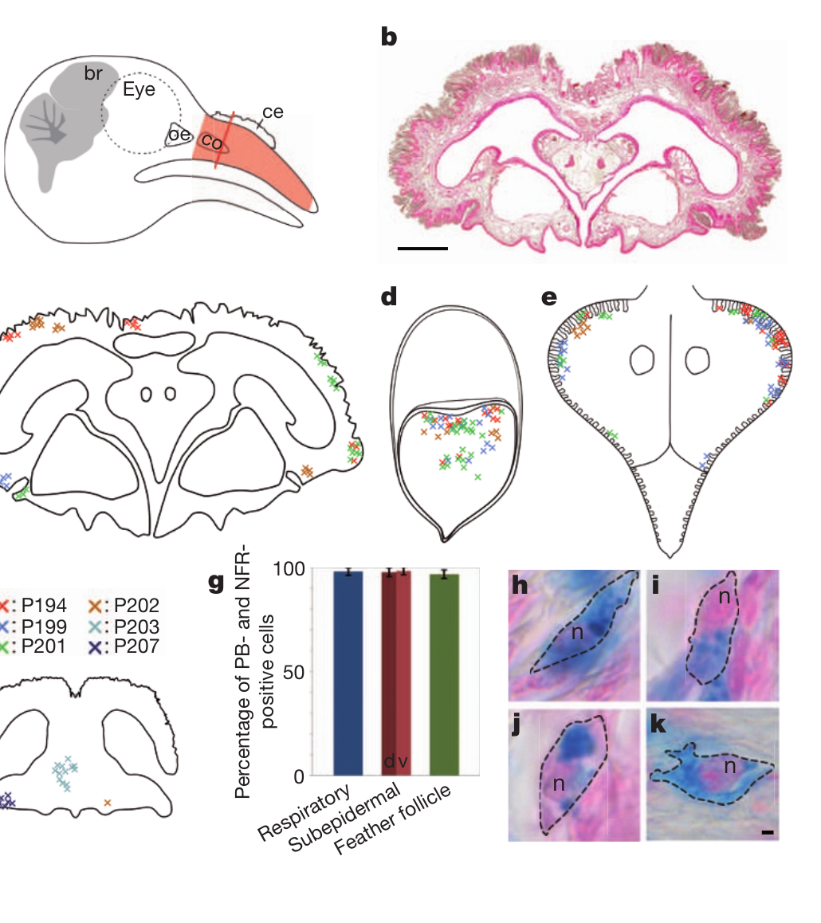
Iron staining does not identify a magnetic neuron
A proposed alternative receptor uses magnetite, an iron oxide whose particles can interact with magnetic fields. Treiber and colleagues reexamined iron-rich cells in pigeon upper beaks that had been proposed as magnetosensitive neurons. Prussian blue staining detects a form of iron accumulation but does not establish neuronal identity.
Iron-positive cells occurred in subepidermal tissue, respiratory epithelium and feather follicles. Their positions and abundance varied strongly across birds rather than forming the claimed stereotyped bilateral sensory arrangement. At least 97% of the stained cells in the examined compartments contained visible nuclei.
The anatomy challenged identification of this particular iron-rich population as an organized receptor system. A material sensitive to magnetism must be linked to an identified sensory cell and pathway before it can be considered a receptor, and the iron-positive cells varied strongly across birds.
Treiber et al. (2012), Fig. 1(a–k). Iron-positive cells occur in several upper-beak compartments.
Treiber et al. (2012)
43
Notes:
• A proposed alternative receptor uses magnetite, an iron oxide whose particles can interact with magnetic fields. Treiber and colleagues reexamined iron-rich cells in pigeon upper beaks that had been proposed as magnetosensitive neurons. Prussian blue staining detects a form of iron accumulation but does not establish neuronal identity.
– The pigeon is a different species from the robin and reed warbler. The negative anatomical finding constrains a specific upper-beak receptor claim, rather than directly locating the receptor responsible for every trigeminally mediated map response.
• Iron-positive cells occurred in subepidermal tissue, respiratory epithelium and feather follicles. Their positions and abundance varied strongly across birds rather than forming the claimed stereotyped bilateral sensory arrangement. At least 97% of the stained cells in the examined compartments contained visible nuclei.
• The anatomy challenged identification of this particular iron-rich population as an organized receptor system. A material sensitive to magnetism must be linked to an identified sensory cell and pathway before it can be considered a receptor, and the iron-positive cells varied strongly across birds.
References:
Treiber CD, Salzer MC, Riegler J, Edelman N, Sugar C, Breuss M, Pichler P, Cadiou H, Saunders M, Lythgoe M, Shaw J, Keays DA (2012). Clusters of iron-rich cells in the upper beak of pigeons are macrophages not magnetosensitive neurons. Nature 484(7394):367-370. https://doi.org/10.1038/nature11046
Figure: Treiber et al. (2012), Fig. 1(a–k). Iron-positive cells occur in several upper-beak compartments.
Figure source: https://doi.org/10.1038/nature11046

Slide 57
Prussian blue stains iron and not cell identity
Prussian blue stains a form of iron accumulation in tissue. A stained cell contains iron, but the stain does not show what kind of cell it is, so cell identity has to be established with other markers. The stain is a first step, and other markers are needed to decide what the stained cell is.
Treiber and colleagues reexamined iron-rich cells in pigeon upper beaks that had been proposed as magnetosensitive neurons. The iron-positive cells occurred in subepidermal tissue, respiratory epithelium and feather follicles.
Their positions and abundance varied strongly across birds, and at least 97% of the stained cells in the examined compartments had visible nuclei. The cells did not form the stereotyped bilateral arrangement that a sensory organ would show. The distribution of iron-positive cells was therefore inconsistent with a sensory organ.
Treiber et al. (2012), Fig. 1(a–k). Iron-positive cells occur in several upper-beak compartments.
Treiber et al. (2012)
43a
Notes:
• A stain that detects a material cannot identify a cell by itself.
• Stain.
– Prussian blue detects a form of iron accumulation.
– It does not establish neuronal identity.
• The proposal.
– Iron-rich cells in the upper beak of pigeons had been proposed as magnetosensitive neurons.
• Where the cells were.
– Iron-positive cells occurred in subepidermal tissue, respiratory epithelium and feather follicles.
• Variability.
– Their positions and abundance varied strongly across birds.
– They did not form a stereotyped bilateral arrangement.
• Nuclei.
– At least 97 percent of the stained cells in the examined compartments contained visible nuclei.
• Meaning.
– A magnetic material has to be linked to an identified sensory cell and pathway to be a receptor.
• Sample details.
– Iron-positive cells were examined in several compartments of the upper beak.
– Their number differed greatly between individual birds.
• Why the identification matters.
– A receptor would need to show a consistent position and a connection to the nervous system.
References:
Treiber CD, Salzer MC, Riegler J, Edelman N, Sugar C, Breuss M, Pichler P, Cadiou H, Saunders M, Lythgoe M, Shaw J, Keays DA (2012). Clusters of iron-rich cells in the upper beak of pigeons are macrophages not magnetosensitive neurons. Nature 484(7394):367-370. https://doi.org/10.1038/nature11046

Slide 58
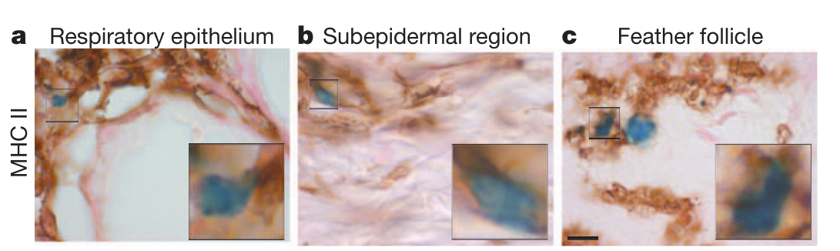
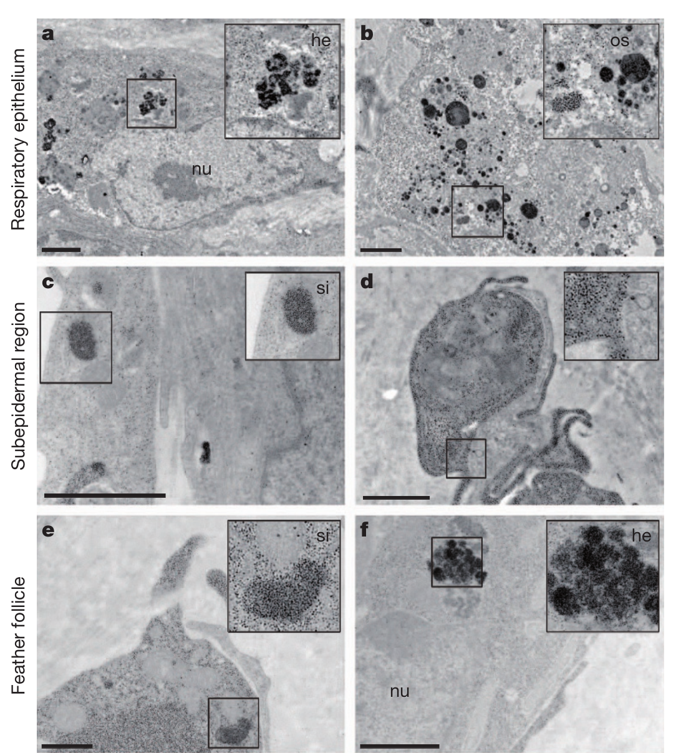
Iron-rich upper-beak cells are macrophages
Macrophages are immune cells that can accumulate and process material within tissues. Treiber and colleagues combined iron staining with neuronal markers, immune-marker staining and electron microscopy. This approach tested cell identity rather than assuming that an iron deposit near a sensory nerve is part of a magnetoreceptor.
The iron-positive populations rarely overlapped the tested neuronal markers and overlapped MHC class II, an antigen-presentation marker. Electron microscopy revealed ferritin-like granules about 6–9 nm across and iron-containing structures including siderosomes approximately 300 nm in size.
These results support macrophage identity for the examined cells. The iron-rich clusters examined in the upper beak are therefore immune cells and not magnetosensitive neurons, and the peripheral source of trigeminal magnetic information is a separate question.
Treiber et al. (2012), Fig. 4(a–c). Immune-marker staining identifies iron-rich cells as macrophages.
Treiber et al. (2012), Fig. 3(a–f). Electron microscopy of iron-storing granules and siderosomes.
Treiber et al. (2012)
44
Notes:
• Macrophages are immune cells that can accumulate and process material within tissues. Treiber and colleagues combined iron staining with neuronal markers, immune-marker staining and electron microscopy. This approach tested cell identity rather than assuming that an iron deposit near a sensory nerve is part of a magnetoreceptor.
– Ferritin stores iron, and siderosomes are iron-rich intracellular structures. Their presence can reflect immune-cell iron handling rather than a sensory transducer; chemical composition must be interpreted together with cellular identity and physiological function.
• The iron-positive populations rarely overlapped the tested neuronal markers and overlapped MHC class II, an antigen-presentation marker. Electron microscopy revealed ferritin-like granules about 6–9 nm across and iron-containing structures including siderosomes approximately 300 nm in size.
• These results support macrophage identity for the examined cells. The iron-rich clusters examined in the upper beak are therefore immune cells and not magnetosensitive neurons, and the peripheral source of trigeminal magnetic information is a separate question.
References:
Treiber CD, Salzer MC, Riegler J, Edelman N, Sugar C, Breuss M, Pichler P, Cadiou H, Saunders M, Lythgoe M, Shaw J, Keays DA (2012). Clusters of iron-rich cells in the upper beak of pigeons are macrophages not magnetosensitive neurons. Nature 484(7394):367-370. https://doi.org/10.1038/nature11046
Figure: Treiber et al. (2012), Fig. 4(a–c). Immune-marker staining identifies iron-rich cells as macrophages.
Figure source: https://doi.org/10.1038/nature11046
Figure: Treiber et al. (2012), Fig. 3(a–f). Electron microscopy of iron-storing granules and siderosomes.
Figure source: https://doi.org/10.1038/nature11046

Slide 59
Map and compass evidence supports distinct mechanisms
The turtle studies distinguish regional-field recognition from the direction selected after recognition. A learned food-anticipatory assay tests magnetic signatures without requiring a compass heading, whereas hatchling swimming assays can require both positional cues and directional information to produce an appropriate course.
Radiofrequency exposure spared learned turtle map discrimination but disrupted the compass-dependent orientation task. A strong magnetic pulse reduced learned map responses. In birds, Cluster N lesions disrupted compass behavior, whereas trigeminal sections impaired map compensation in reed warblers while sparing the tested robin compass.
The converging evidence supports separable functions and candidate transduction processes, with important differences between species and preparations. Cry4 localization and purified photochemistry support a radical-pair hypothesis; particle-based maps remain plausible but lack an identified receptor pathway. The receptor-to-behavior circuits, including the transmitters and ion channels, connect these candidate mechanisms to behavior.
Goforth et al. (2025), Fig. 5(a–b). Map discrimination and compass-dependent orientation dissociate.
Günther et al. (2018), Fig. 7(A–F). Published Cry4 structural model and FAD-binding region.
Goforth et al. (2025); Mackiewicz et al. (2025); Zapka et al. (2009); Pakhomov et al. (2018); Günther et al. (2018); Xu et al. (2021)
45
Notes:
• The turtle studies distinguish regional-field recognition from the direction selected after recognition. A learned food-anticipatory assay tests magnetic signatures without requiring a compass heading, whereas hatchling swimming assays can require both positional cues and directional information to produce an appropriate course.
– Functional separation does not require that a navigation system use each sense independently during natural travel. A map can select the appropriate course and a compass can maintain it, while other sensory information influences both decisions.
• Radiofrequency exposure spared learned turtle map discrimination but disrupted the compass-dependent orientation task. A strong magnetic pulse reduced learned map responses. In birds, Cluster N lesions disrupted compass behavior, whereas trigeminal sections impaired map compensation in reed warblers while sparing the tested robin compass.
• The converging evidence supports separable functions and candidate transduction processes, with important differences between species and preparations. Cry4 localization and purified photochemistry support a radical-pair hypothesis; particle-based maps remain plausible but lack an identified receptor pathway. The receptor-to-behavior circuits, including the transmitters and ion channels, connect these candidate mechanisms to behavior.
References:
Goforth KM, Lohmann CMF, Gavin A, Henning R, Harvey A, Hinton TL, Lim DS, Lohmann KJ (2025). Learned magnetic map cues and two mechanisms of magnetoreception in turtles. Nature 638(8052):1015-1022. https://doi.org/10.1038/s41586-024-08554-y
Mackiewicz AG, Glazener AM, Goforth KM, Lim DS, Lohmann CMF, Lohmann KJ (2025). Disruption of the sea turtle magnetic map sense by a magnetic pulse. Journal of Experimental Biology 228(22):jeb251243. https://doi.org/10.1242/jeb.251243
Zapka M, Heyers D, Hein CM, Engels S, Schneider NL, Hans J, Weiler S, Dreyer D, Kishkinev D, Wild JM, Mouritsen H (2009). Visual but not trigeminal mediation of magnetic compass information in a migratory bird. Nature 461(7268):1274-1277. https://doi.org/10.1038/nature08528
Pakhomov A, Anashina A, Heyers D, Kobylkov D, Mouritsen H, Chernetsov N (2018). Magnetic map navigation in a migratory songbird requires trigeminal input. Scientific Reports 8(1):11975. https://doi.org/10.1038/s41598-018-30477-8
Günther A, Einwich A, Sjulstok E, Feederle R, Bolte P, Koch KW, Solov’yov IA, Mouritsen H (2018). Double-Cone Localization and Seasonal Expression Pattern Suggest a Role in Magnetoreception for European Robin Cryptochrome 4. Current Biology 28(2):211-223.e4. https://doi.org/10.1016/j.cub.2017.12.003
Xu J, Jarocha LE, Zollitsch T, Konowalczyk M, Henbest KB, Richert S, Golesworthy MJ, Schmidt J, Déjean V, Sowood DJC, Bassetto M, Luo J, Walton JR, Fleming J, Wei Y, Pitcher TL, Moise G, Herrmann M, Yin H, Wu H, Bartölke R, Käsehagen SJ, Horst S, Dautaj G, Murton PDF, Gehrckens AS, Chelliah Y, Takahashi JS, Koch KW, Weber S, Solov’yov IA, Xie C, Mackenzie SR, Timmel CR, Mouritsen H, Hore PJ (2021). Magnetic sensitivity of cryptochrome 4 from a migratory songbird. Nature 594(7864):535-540. https://doi.org/10.1038/s41586-021-03618-9
Figure: Goforth et al. (2025), Fig. 5(a–b). Map discrimination and compass-dependent orientation dissociate.
Figure source: https://doi.org/10.1038/s41586-024-08554-y
Figure: Günther et al. (2018), Fig. 7(A–F). Published Cry4 structural model and FAD-binding region.
Figure source: https://doi.org/10.1016/j.cub.2017.12.003

Slide 60
Key takeaways
Compass and map differ A compass supplies direction; a magnetic map uses location-related field information. An orientation assay can require both.
Turtles discriminate field geometry Controlled inclination and regional-field changes evoke different swimming headings, including appropriate responses in ocean-inexperienced hatchlings.
Magnetic signatures can be learned Juvenile loggerheads learn compound inclination–intensity cues and retain rewarded-field discrimination for at least four months.
Bird pathways serve different tasks Cluster N is necessary for the tested robin magnetic compass; V1 input is necessary for magnetic map compensation in reed warblers.
Cry4 is a supported candidate Retinal localization, antibody controls and magnetic-sensitive purified photochemistry support a radical-pair hypothesis without proving its complete neural mechanism.
Receptor identity remains unresolved Pulse effects support candidate particle-based maps, but iron-positive beak cells can be macrophages; a magnetic material alone is not an identified sensory receptor.
Lohmann et al. (2001); Goforth et al. (2025); Zapka et al. (2009); Pakhomov et al. (2018); Günther et al. (2018); Xu et al. (2021); Treiber et al. (2012)
46
Notes:
• Compass and map differ. A compass supplies direction; a magnetic map uses location-related field information. An orientation assay can require both.
• Turtles discriminate field geometry. Controlled inclination and regional-field changes evoke different swimming headings, including appropriate responses in ocean-inexperienced hatchlings.
• Magnetic signatures can be learned. Juvenile loggerheads learn compound inclination–intensity cues and retain rewarded-field discrimination for at least four months.
• Bird pathways serve different tasks. Cluster N is necessary for the tested robin magnetic compass; V1 input is necessary for magnetic map compensation in reed warblers.
• Cry4 is a supported candidate. Retinal localization, antibody controls and magnetic-sensitive purified photochemistry support a radical-pair hypothesis without proving its complete neural mechanism.
• Receptor identity remains unresolved. Pulse effects support candidate particle-based maps, but iron-positive beak cells can be macrophages; a magnetic material alone is not an identified sensory receptor.
References:
Lohmann KJ, Cain SD, Dodge SA, Lohmann CMF (2001). Regional Magnetic Fields as Navigational Markers for Sea Turtles. Science 294(5541):364-366. https://doi.org/10.1126/science.1064557
Goforth KM, Lohmann CMF, Gavin A, Henning R, Harvey A, Hinton TL, Lim DS, Lohmann KJ (2025). Learned magnetic map cues and two mechanisms of magnetoreception in turtles. Nature 638(8052):1015-1022. https://doi.org/10.1038/s41586-024-08554-y
Mackiewicz AG, Glazener AM, Goforth KM, Lim DS, Lohmann CMF, Lohmann KJ (2025). Disruption of the sea turtle magnetic map sense by a magnetic pulse. Journal of Experimental Biology 228(22):jeb251243. https://doi.org/10.1242/jeb.251243
Zapka M, Heyers D, Hein CM, Engels S, Schneider NL, Hans J, Weiler S, Dreyer D, Kishkinev D, Wild JM, Mouritsen H (2009). Visual but not trigeminal mediation of magnetic compass information in a migratory bird. Nature 461(7268):1274-1277. https://doi.org/10.1038/nature08528
Pakhomov A, Anashina A, Heyers D, Kobylkov D, Mouritsen H, Chernetsov N (2018). Magnetic map navigation in a migratory songbird requires trigeminal input. Scientific Reports 8(1):11975. https://doi.org/10.1038/s41598-018-30477-8
Günther A, Einwich A, Sjulstok E, Feederle R, Bolte P, Koch KW, Solov’yov IA, Mouritsen H (2018). Double-Cone Localization and Seasonal Expression Pattern Suggest a Role in Magnetoreception for European Robin Cryptochrome 4. Current Biology 28(2):211-223.e4. https://doi.org/10.1016/j.cub.2017.12.003
Xu J, Jarocha LE, Zollitsch T, Konowalczyk M, Henbest KB, Richert S, Golesworthy MJ, Schmidt J, Déjean V, Sowood DJC, Bassetto M, Luo J, Walton JR, Fleming J, Wei Y, Pitcher TL, Moise G, Herrmann M, Yin H, Wu H, Bartölke R, Käsehagen SJ, Horst S, Dautaj G, Murton PDF, Gehrckens AS, Chelliah Y, Takahashi JS, Koch KW, Weber S, Solov’yov IA, Xie C, Mackenzie SR, Timmel CR, Mouritsen H, Hore PJ (2021). Magnetic sensitivity of cryptochrome 4 from a migratory songbird. Nature 594(7864):535-540. https://doi.org/10.1038/s41586-021-03618-9
Treiber CD, Salzer MC, Riegler J, Edelman N, Sugar C, Breuss M, Pichler P, Cadiou H, Saunders M, Lythgoe M, Shaw J, Keays DA (2012). Clusters of iron-rich cells in the upper beak of pigeons are macrophages not magnetosensitive neurons. Nature 484(7394):367-370. https://doi.org/10.1038/nature11046

