Slide 1
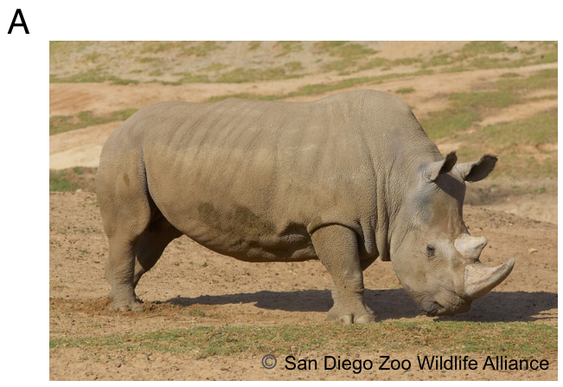
NEUR 411 · NEUROETHOLOGY · FALL 2026
Lecture 68
Rhinoceroses:
brain/neuro anatomy & organization, olfactory and auditory systems, territorial signaling, and social recognition
Date TBD
Jordan Lopez, Ph.D.
Professor of Neurobiology & Biomedical Engineering
Wang et al. (2025), Fig. 1A. Angalifu, a northern white rhinoceros. Photo: San Diego Zoo Wildlife Alliance.
Notes:
Rhinoceroses: brain/neuro anatomy & organization, olfactory and auditory systems, territorial signaling, and social recognition
Lecture 68. NEUR 411 · NEUROETHOLOGY · FALL 2026. Date TBD.
Figure: Wang et al. (2025), Fig. 1A. Angalifu, a northern white rhinoceros. Photo: San Diego Zoo Wildlife Alliance.
Figure source: https://doi.org/10.1073/pnas.2401207122
References:
Wang G; Korody ML; Brändl B; Hernandez-Toro CJ; Rohrandt C; Hong K; Pang AWC; Lee J; Migliorelli G; Stanke M; Ford SM; Pollmann I; Houck ML; Lewin HA; Lear TL; Ryder OA; Meissner A; Loring JF; Müller FJ. (2025). Genomic map of the functionally extinct northern white rhinoceros ( Ceratotherium simum cottoni ). Proceedings of the National Academy of Sciences 122:e2401207122. https://doi.org/10.1073/pnas.2401207122

Slide 2
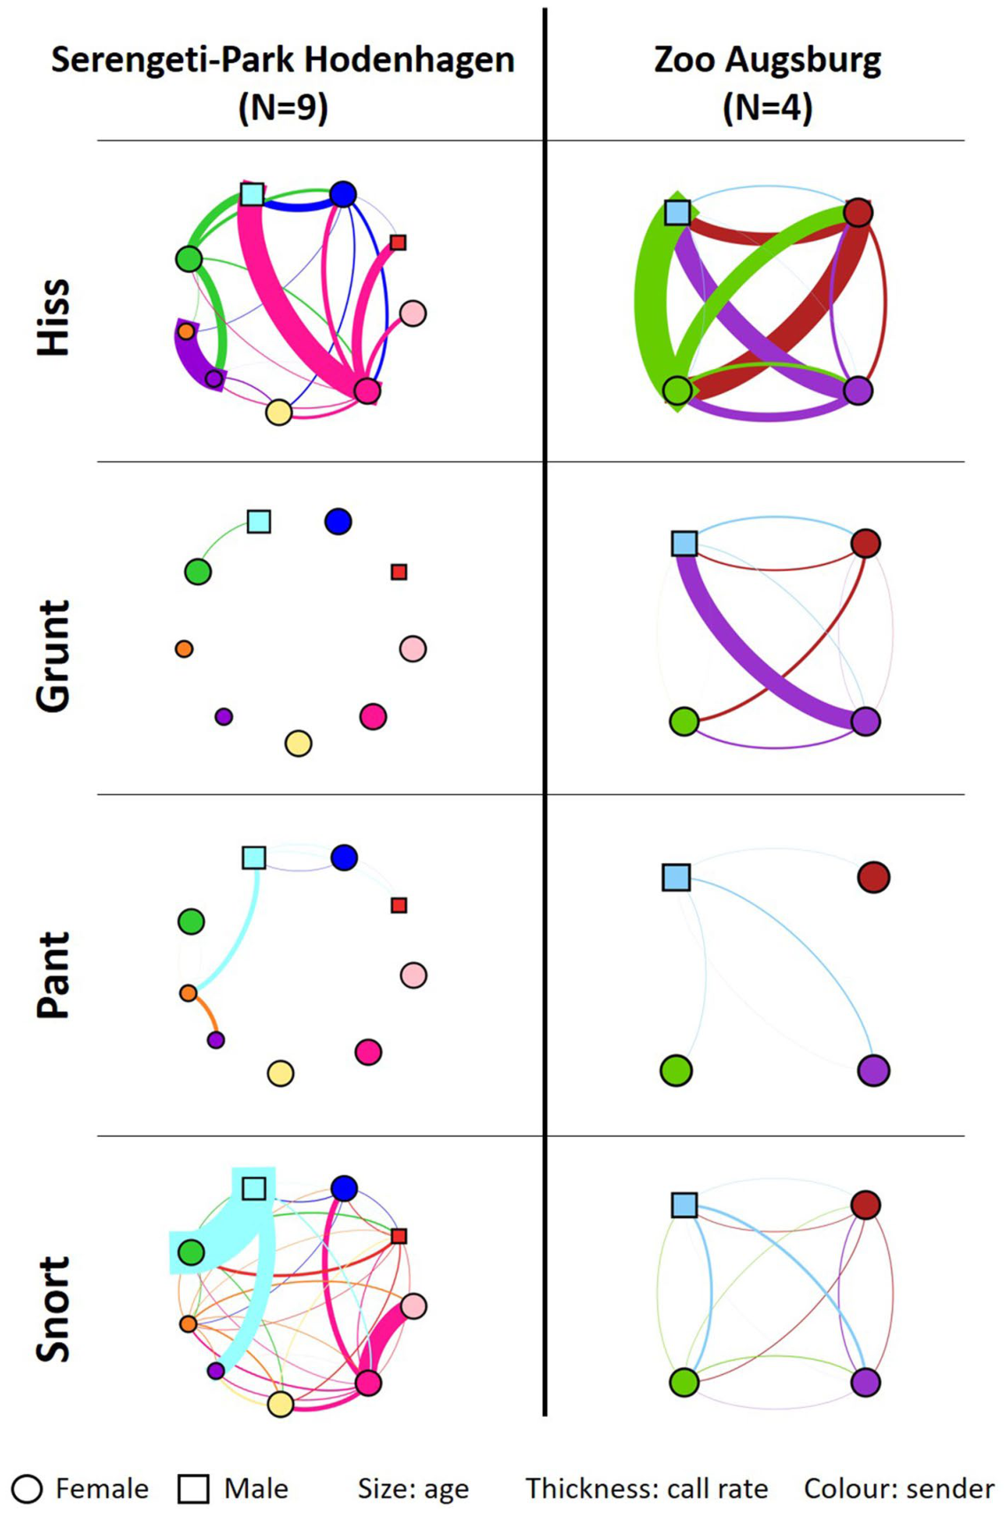
Shared space creates several kinds of social signals
Southern white rhinoceroses communicate while approaching companions, defending access to space, and maintaining contact. Social recognition means using information about another animal to guide a response, rather than merely detecting that an animal is present. Vocal and chemical experiments provide different ways to investigate that process.
Jenikejew and colleagues recorded calls and the nearby animals in managed groups. They treated an animal within one body length as a potential receiver and expressed directed calling relative to time spent together. This connects a vocal event to an observable social setting.
The resulting networks differed among call types. Hisses were especially associated with agonistic interactions, whereas contact pants accompanied affiliation and approach. A network therefore describes how a particular signal participates in relationships; the meaning depends on the call and its context.
Jenikejew et al. (2020), Fig. 2. Shared space creates several kinds of social signals.
Jenikejew et al. (2020)
02
Notes:
• Southern white rhinoceroses communicate while approaching companions, defending access to space, and maintaining contact. Social recognition means using information about another animal to guide a response, rather than merely detecting that an animal is present. Vocal and chemical experiments provide different ways to investigate that process.
• Jenikejew and colleagues recorded calls and the nearby animals in managed groups. They treated an animal within one body length as a potential receiver and expressed directed calling relative to time spent together. This connects a vocal event to an observable social setting.
• The resulting networks differed among call types. Hisses were especially associated with agonistic interactions, whereas contact pants accompanied affiliation and approach. A network therefore describes how a particular signal participates in relationships; the meaning depends on the call and its context.
• Read the original figure together with the claim. Read the directed links relative to the animals and their time in proximity. A nearby animal is a potential recipient, not automatically a proven intended recipient. Call-specific networks reveal patterns that an undifferentiated count of all calls would conceal.
References:
Jenikejew J; Chaignon B; Linn S; Scheumann M. (2020). Proximity-based vocal networks reveal social relationships in the Southern white rhinoceros. Scientific Reports 10:15104. https://doi.org/10.1038/s41598-020-72052-0
Figure: Jenikejew et al. (2020), Fig. 2. Shared space creates several kinds of social signals.
Figure source: https://doi.org/10.1038/s41598-020-72052-0

Slide 3
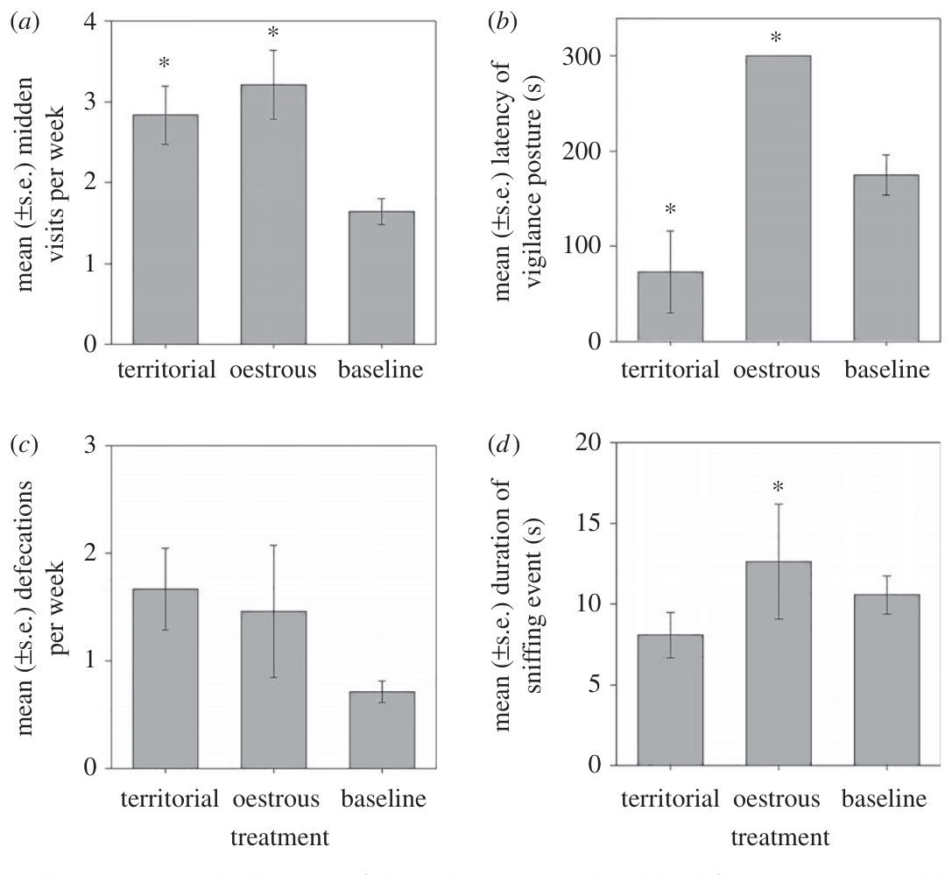
Middens distribute information beyond direct encounters
A midden is a repeatedly used communal defecation site. Southern white rhinoceroses visit middens throughout territories, so deposited dung can convey information even when its producer has left. Territorial males commonly deposit and scatter dung near the center, while other animals often use the margins.
Marneweck and colleagues collected fresh dung and tested experimentally constructed odor mixtures at established middens. Their field experiment measured visits, sniffing, vigilance, and defecation. These behaviors reveal distinct components of the recipient's response to a persistent chemical signal.
A rival-like mixture increased territorial males' visits and vigilance, while a female reproductive-state mixture prolonged investigation. Chemical communication thus changes how an animal samples and monitors its surroundings. Persistent deposits extend social information across both space and time.
Marneweck et al. (2017), Fig. 2. Middens distribute information beyond direct encounters.
Marneweck et al. (2017)
03
Notes:
• A midden is a repeatedly used communal defecation site. Southern white rhinoceroses visit middens throughout territories, so deposited dung can convey information even when its producer has left. Territorial males commonly deposit and scatter dung near the center, while other animals often use the margins.
• Marneweck and colleagues collected fresh dung and tested experimentally constructed odor mixtures at established middens. Their field experiment measured visits, sniffing, vigilance, and defecation. These behaviors reveal distinct components of the recipient's response to a persistent chemical signal.
• A rival-like mixture increased territorial males' visits and vigilance, while a female reproductive-state mixture prolonged investigation. Chemical communication thus changes how an animal samples and monitors its surroundings. Persistent deposits extend social information across both space and time.
• Read the original figure together with the claim. Compare visits, investigation, and vigilance as separate behavioral measurements. The artificial mixtures reproduce a multicomponent odor presentation at a midden; the experiment does not identify a receptor for an isolated molecule.
References:
Marneweck C; Jürgens A; Shrader AM. (2017). Dung odours signal sex, age, territorial and oestrous state in white rhinos. Proceedings of the Royal Society B: Biological Sciences 284:20162376. https://doi.org/10.1098/rspb.2016.2376
Figure: Marneweck et al. (2017), Fig. 2. Middens distribute information beyond direct encounters.
Figure source: https://doi.org/10.1098/rspb.2016.2376

Slide 4
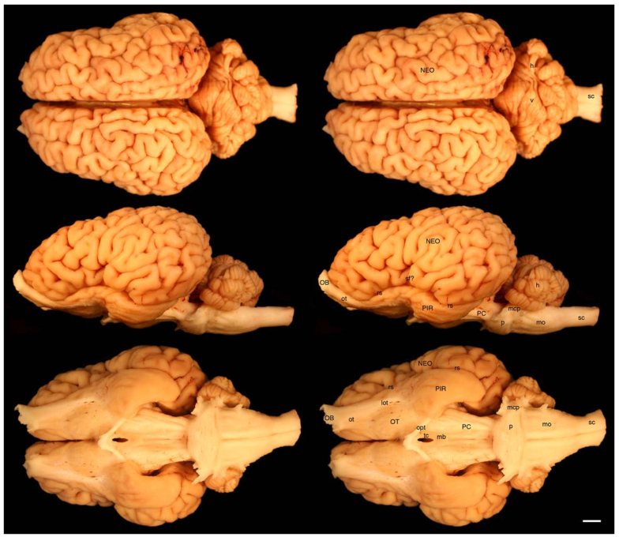
MRI places rhinoceros brains within mammalian anatomy
Bhagwandin and colleagues examined a black rhinoceros brain and a white rhinoceros brain using magnetic resonance imaging, which distinguishes tissues through their magnetic resonance signals. The fixed brains weighed 531 g and 536.5 g, respectively. Contiguous image slices were 2 mm thick.
The preparations revealed cerebral hemispheres, olfactory structures, a cerebellum, and a brainstem. These are recognizable mammalian subdivisions rather than a single undifferentiated sensory center. The gross views also show how deeply folded cortex surrounds internal structures.
The black rhinoceros was an approximately 40-year-old male and the white rhinoceros an approximately 3-year-old female. Their comparison therefore documents two brains rather than isolating a species effect. The shared arrangement supplies the anatomical framework for interpreting olfactory, auditory, and social behavior.
Bhagwandin et al. (2017), Fig. 2. MRI places rhinoceros brains within mammalian anatomy.
Bhagwandin et al. (2017)
04
Notes:
• Bhagwandin and colleagues examined a black rhinoceros brain and a white rhinoceros brain using magnetic resonance imaging, which distinguishes tissues through their magnetic resonance signals. The fixed brains weighed 531 g and 536.5 g, respectively. Contiguous image slices were 2 mm thick.
• The preparations revealed cerebral hemispheres, olfactory structures, a cerebellum, and a brainstem. These are recognizable mammalian subdivisions rather than a single undifferentiated sensory center. The gross views also show how deeply folded cortex surrounds internal structures.
• The black rhinoceros was an approximately 40-year-old male and the white rhinoceros an approximately 3-year-old female. Their comparison therefore documents two brains rather than isolating a species effect. The shared arrangement supplies the anatomical framework for interpreting olfactory, auditory, and social behavior.
• Read the original figure together with the claim. Follow each structure across the labeled views and use the scale bar to relate its position to neighboring tissue. These fixed-brain observations identify anatomical organization; they are complementary to behavioral experiments on live animals.
References:
Bhagwandin A; Haagensen M; Manger PR. (2017). The Brain of the Black (Diceros bicornis) and White (Ceratotherium simum) African Rhinoceroses: Morphology and Volumetrics from Magnetic Resonance Imaging. Frontiers in Neuroanatomy 11:74. https://doi.org/10.3389/fnana.2017.00074
Figure: Bhagwandin et al. (2017), Fig. 2. MRI places rhinoceros brains within mammalian anatomy.
Figure source: https://doi.org/10.3389/fnana.2017.00074

Slide 5
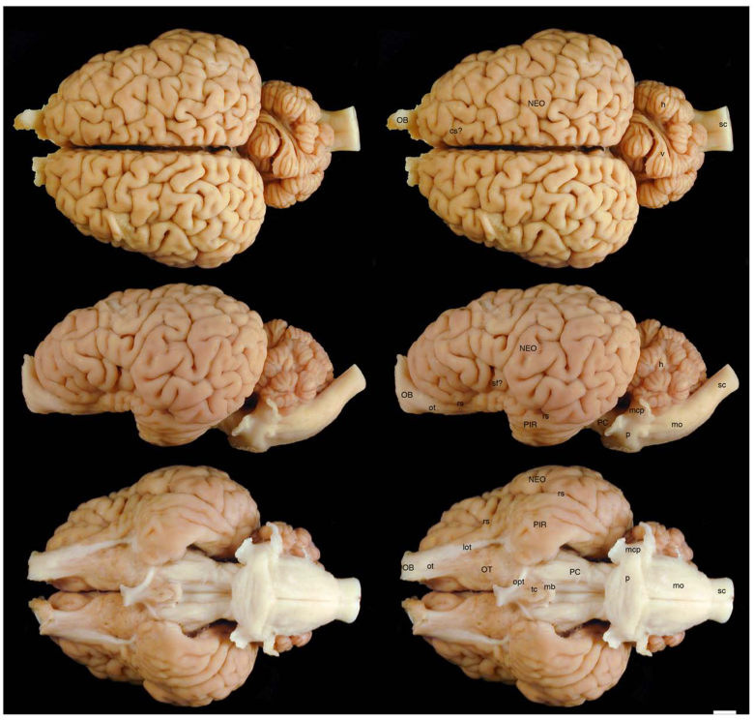
Similar brain masses accompany different surface shapes
The black and white rhinoceros brains had similar masses but differed in their external proportions. The black rhinoceros hemisphere extended approximately 9.3 cm rostrocaudally, compared with 10.7 cm in the white rhinoceros preparation. Rostrocaudal describes the direction from the front toward the rear of the brain.
Gross photographs reveal sulci, the grooves between folds, and gyri, the raised cortical folds. Their positions vary across surfaces and between hemispheres. A visible groove provides a landmark for describing a specimen, but identifying a functional cortical area requires additional evidence.
Both brains retain the same broad relationship between cerebral cortex, underlying white matter, and the brainstem. Similar overall mass can therefore coexist with differences in shape and folding. Surface anatomy is a starting point for mapping pathways rather than a direct measure of behavioral ability.
Bhagwandin et al. (2017), Fig. 1. Similar brain masses accompany different surface shapes.
Bhagwandin et al. (2017)
05
Notes:
• The black and white rhinoceros brains had similar masses but differed in their external proportions. The black rhinoceros hemisphere extended approximately 9.3 cm rostrocaudally, compared with 10.7 cm in the white rhinoceros preparation. Rostrocaudal describes the direction from the front toward the rear of the brain.
• Gross photographs reveal sulci, the grooves between folds, and gyri, the raised cortical folds. Their positions vary across surfaces and between hemispheres. A visible groove provides a landmark for describing a specimen, but identifying a functional cortical area requires additional evidence.
• Both brains retain the same broad relationship between cerebral cortex, underlying white matter, and the brainstem. Similar overall mass can therefore coexist with differences in shape and folding. Surface anatomy is a starting point for mapping pathways rather than a direct measure of behavioral ability.
• Read the original figure together with the claim. Follow each structure across the labeled views and use the scale bar to relate its position to neighboring tissue. These fixed-brain observations identify anatomical organization; they are complementary to behavioral experiments on live animals.
References:
Bhagwandin A; Haagensen M; Manger PR. (2017). The Brain of the Black (Diceros bicornis) and White (Ceratotherium simum) African Rhinoceroses: Morphology and Volumetrics from Magnetic Resonance Imaging. Frontiers in Neuroanatomy 11:74. https://doi.org/10.3389/fnana.2017.00074
Figure: Bhagwandin et al. (2017), Fig. 1. Similar brain masses accompany different surface shapes.
Figure source: https://doi.org/10.3389/fnana.2017.00074

Slide 6
Olfactory bulbs occupy the front of the brain
The olfactory bulb is the first major brain structure receiving input from olfactory sensory neurons. In the rhinoceros preparations, the bulbs occupy the rostral end of the cerebral hemispheres. Their position links the nasal sensory apparatus to the ventral forebrain.
Removing these large brains disrupted parts of the bulbs because a fold of dura surrounded their attachment. The dura is a tough protective membrane covering the brain. The remaining tissue and the bulb-associated ventricle nevertheless identify the rostral olfactory region in the anatomical study.
From this region, olfactory pathways run backward along the brain's underside. That arrangement provides a route by which information about dung, urine, and other odor sources can enter forebrain processing. The behavioral experiments later test which social information the animals extract from those sources.
Bhagwandin et al. (2017), Fig. 2. Olfactory bulbs occupy the front of the brain.
Bhagwandin et al. (2017)
06
Notes:
• The olfactory bulb is the first major brain structure receiving input from olfactory sensory neurons. In the rhinoceros preparations, the bulbs occupy the rostral end of the cerebral hemispheres. Their position links the nasal sensory apparatus to the ventral forebrain.
• Removing these large brains disrupted parts of the bulbs because a fold of dura surrounded their attachment. The dura is a tough protective membrane covering the brain. The remaining tissue and the bulb-associated ventricle nevertheless identify the rostral olfactory region in the anatomical study.
• From this region, olfactory pathways run backward along the brain's underside. That arrangement provides a route by which information about dung, urine, and other odor sources can enter forebrain processing. The behavioral experiments later test which social information the animals extract from those sources.
• Read the original figure together with the claim. Follow each structure across the labeled views and use the scale bar to relate its position to neighboring tissue. These fixed-brain observations identify anatomical organization; they are complementary to behavioral experiments on live animals.
References:
Bhagwandin A; Haagensen M; Manger PR. (2017). The Brain of the Black (Diceros bicornis) and White (Ceratotherium simum) African Rhinoceroses: Morphology and Volumetrics from Magnetic Resonance Imaging. Frontiers in Neuroanatomy 11:74. https://doi.org/10.3389/fnana.2017.00074
Figure: Bhagwandin et al. (2017), Fig. 2. Olfactory bulbs occupy the front of the brain.
Figure source: https://doi.org/10.3389/fnana.2017.00074

Slide 7
An olfactory tract connects the bulb to ventral forebrain
An olfactory tract is a bundle of axons carrying output from the olfactory bulb into the forebrain. Bhagwandin and colleagues described a broad tract, approximately 15 mm wide, on the ventral surface of the rhinoceros brain. Its location is visible in the gross anatomical views.
The tract passes near the olfactory tubercle and continues toward the piriform region. The olfactory tubercle is a ventral forebrain structure associated with olfactory processing in mammals. The neighboring rhinal sulcus helps distinguish this region from the lateral cortical surface.
The arrangement distributes bulb output among several forebrain destinations. Odor-guided behavior consequently involves a pathway through connected structures rather than a response generated by the nose alone. This anatomical route helps explain why chemical signals can influence investigation, approach, and territorial monitoring.
Bhagwandin et al. (2017), Fig. 2. An olfactory tract connects the bulb to ventral forebrain.
Bhagwandin et al. (2017)
07
Notes:
• An olfactory tract is a bundle of axons carrying output from the olfactory bulb into the forebrain. Bhagwandin and colleagues described a broad tract, approximately 15 mm wide, on the ventral surface of the rhinoceros brain. Its location is visible in the gross anatomical views.
• The tract passes near the olfactory tubercle and continues toward the piriform region. The olfactory tubercle is a ventral forebrain structure associated with olfactory processing in mammals. The neighboring rhinal sulcus helps distinguish this region from the lateral cortical surface.
• The arrangement distributes bulb output among several forebrain destinations. Odor-guided behavior consequently involves a pathway through connected structures rather than a response generated by the nose alone. This anatomical route helps explain why chemical signals can influence investigation, approach, and territorial monitoring.
• Read the original figure together with the claim. Follow each structure across the labeled views and use the scale bar to relate its position to neighboring tissue. These fixed-brain observations identify anatomical organization; they are complementary to behavioral experiments on live animals.
References:
Bhagwandin A; Haagensen M; Manger PR. (2017). The Brain of the Black (Diceros bicornis) and White (Ceratotherium simum) African Rhinoceroses: Morphology and Volumetrics from Magnetic Resonance Imaging. Frontiers in Neuroanatomy 11:74. https://doi.org/10.3389/fnana.2017.00074
Figure: Bhagwandin et al. (2017), Fig. 2. An olfactory tract connects the bulb to ventral forebrain.
Figure source: https://doi.org/10.3389/fnana.2017.00074

Slide 8
Piriform cortex occupies a distinct ventral territory
The piriform cortex is a cortical region associated with processing olfactory information. In the rhinoceros brains it forms part of the ventral temporal surface, separated from more lateral cortex by the rhinal sulcus. The gross photographs establish its position relative to the olfactory tract.
The black rhinoceros specimen had a more conspicuous, folded piriform region than the white rhinoceros specimen. The authors proposed that differences in dietary odor sampling might contribute to this contrast. That explanation is a hypothesis arising from the anatomical comparison.
Olfaction is also used for social signals in both species. Positioning piriform cortex along the bulb's downstream pathway supplies an anatomical connection between odor detection and forebrain processing. The chemical-cue studies show how rhinoceroses use that sensory channel to evaluate sex, familiarity, and reproductive condition.
Bhagwandin et al. (2017), Fig. 1. Piriform cortex occupies a distinct ventral territory.
Bhagwandin et al. (2017)
08
Notes:
• The piriform cortex is a cortical region associated with processing olfactory information. In the rhinoceros brains it forms part of the ventral temporal surface, separated from more lateral cortex by the rhinal sulcus. The gross photographs establish its position relative to the olfactory tract.
• The black rhinoceros specimen had a more conspicuous, folded piriform region than the white rhinoceros specimen. The authors proposed that differences in dietary odor sampling might contribute to this contrast. That explanation is a hypothesis arising from the anatomical comparison.
• Olfaction is also used for social signals in both species. Positioning piriform cortex along the bulb's downstream pathway supplies an anatomical connection between odor detection and forebrain processing. The chemical-cue studies show how rhinoceroses use that sensory channel to evaluate sex, familiarity, and reproductive condition.
• Read the original figure together with the claim. Follow each structure across the labeled views and use the scale bar to relate its position to neighboring tissue. These fixed-brain observations identify anatomical organization; they are complementary to behavioral experiments on live animals.
References:
Bhagwandin A; Haagensen M; Manger PR. (2017). The Brain of the Black (Diceros bicornis) and White (Ceratotherium simum) African Rhinoceroses: Morphology and Volumetrics from Magnetic Resonance Imaging. Frontiers in Neuroanatomy 11:74. https://doi.org/10.3389/fnana.2017.00074
Figure: Bhagwandin et al. (2017), Fig. 1. Piriform cortex occupies a distinct ventral territory.
Figure source: https://doi.org/10.3389/fnana.2017.00074

Slide 9
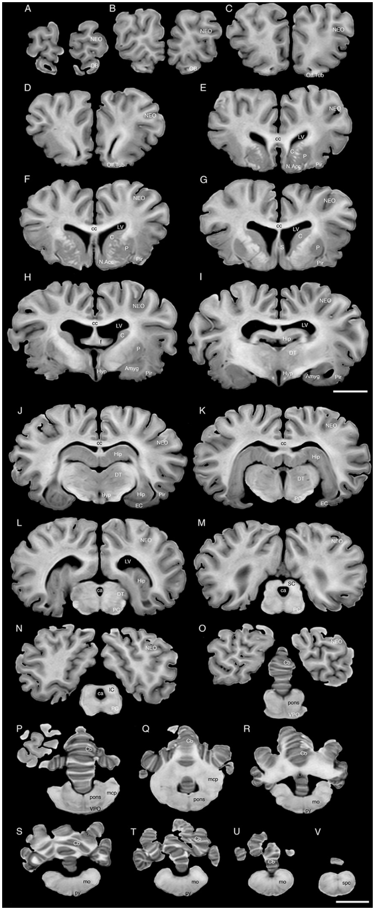
Internal sections reveal olfactory and ventricular spaces
A ventricle is a fluid-containing cavity within the brain. Serial sections through the black rhinoceros preparation show ventricular spaces together with surrounding gray and white matter. The investigators described a small connection between the olfactory ventricular space and the lateral ventricle.
The displayed coronal sections are spaced 6 mm apart. Coronal sections cut across the front-to-back axis, allowing structures on the two sides of the brain to be compared at successive positions. This makes the transition from rostral olfactory regions to deeper forebrain anatomy visible.
The ventricular system supplies useful landmarks because its cavities lie alongside several major structures. Following those landmarks through serial sections helps locate the striatum, temporal regions, and diencephalon. Spatial relationships across consecutive images turn a flat section into an interpretable anatomical sequence.
Bhagwandin et al. (2017), Fig. 3. Internal sections reveal olfactory and ventricular spaces.
Bhagwandin et al. (2017)
09
Notes:
• A ventricle is a fluid-containing cavity within the brain. Serial sections through the black rhinoceros preparation show ventricular spaces together with surrounding gray and white matter. The investigators described a small connection between the olfactory ventricular space and the lateral ventricle.
• The displayed coronal sections are spaced 6 mm apart. Coronal sections cut across the front-to-back axis, allowing structures on the two sides of the brain to be compared at successive positions. This makes the transition from rostral olfactory regions to deeper forebrain anatomy visible.
• The ventricular system supplies useful landmarks because its cavities lie alongside several major structures. Following those landmarks through serial sections helps locate the striatum, temporal regions, and diencephalon. Spatial relationships across consecutive images turn a flat section into an interpretable anatomical sequence.
• Read the original figure together with the claim. Follow each structure across the labeled views and use the scale bar to relate its position to neighboring tissue. These fixed-brain observations identify anatomical organization; they are complementary to behavioral experiments on live animals.
References:
Bhagwandin A; Haagensen M; Manger PR. (2017). The Brain of the Black (Diceros bicornis) and White (Ceratotherium simum) African Rhinoceroses: Morphology and Volumetrics from Magnetic Resonance Imaging. Frontiers in Neuroanatomy 11:74. https://doi.org/10.3389/fnana.2017.00074
Figure: Bhagwandin et al. (2017), Fig. 3. Internal sections reveal olfactory and ventricular spaces.
Figure source: https://doi.org/10.3389/fnana.2017.00074

Slide 10
Cortical folds increase the surface within a compact brain
The rhinoceros cerebral cortex has numerous gyri separated by deep sulci. The gross study described gyri approximately 5–7 mm wide and sulci reaching approximately 2 cm in depth. Cortex refers to the outer gray-matter layer of the cerebral hemispheres.
Folding allows a large cortical sheet to occupy a comparatively compact volume. The rhinoceros surfaces were not perfectly symmetrical: corresponding grooves differed in shape and position between hemispheres. External landmarks therefore need to be followed together with internal sections.
The study measured gyrification values of 2.47 and 2.44 in the two preparations. These values describe folding, not a ranking of intelligence. The photographs teach how cortical tissue is packaged and why visible surface complexity must be interpreted separately from the experiments demonstrating social recognition.
Bhagwandin et al. (2017), Fig. 2. Cortical folds increase the surface within a compact brain.
Bhagwandin et al. (2017)
10
Notes:
• The rhinoceros cerebral cortex has numerous gyri separated by deep sulci. The gross study described gyri approximately 5–7 mm wide and sulci reaching approximately 2 cm in depth. Cortex refers to the outer gray-matter layer of the cerebral hemispheres.
• Folding allows a large cortical sheet to occupy a comparatively compact volume. The rhinoceros surfaces were not perfectly symmetrical: corresponding grooves differed in shape and position between hemispheres. External landmarks therefore need to be followed together with internal sections.
• The study measured gyrification values of 2.47 and 2.44 in the two preparations. These values describe folding, not a ranking of intelligence. The photographs teach how cortical tissue is packaged and why visible surface complexity must be interpreted separately from the experiments demonstrating social recognition.
• Read the original figure together with the claim. Follow each structure across the labeled views and use the scale bar to relate its position to neighboring tissue. These fixed-brain observations identify anatomical organization; they are complementary to behavioral experiments on live animals.
References:
Bhagwandin A; Haagensen M; Manger PR. (2017). The Brain of the Black (Diceros bicornis) and White (Ceratotherium simum) African Rhinoceroses: Morphology and Volumetrics from Magnetic Resonance Imaging. Frontiers in Neuroanatomy 11:74. https://doi.org/10.3389/fnana.2017.00074
Figure: Bhagwandin et al. (2017), Fig. 2. Cortical folds increase the surface within a compact brain.
Figure source: https://doi.org/10.3389/fnana.2017.00074

Slide 11
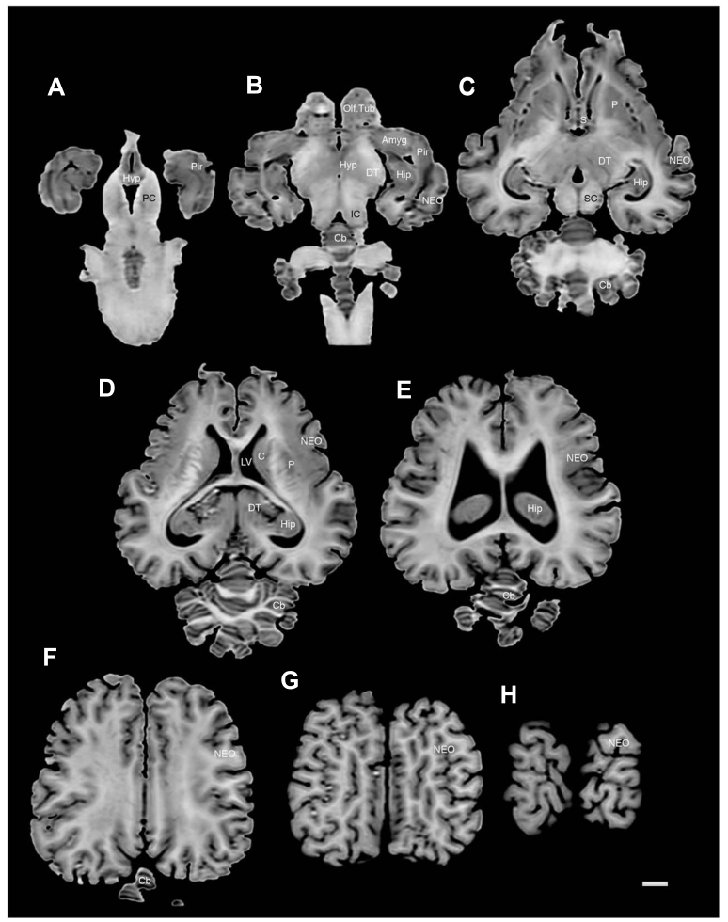
The striatum lies beside the lateral ventricles
The striatum is a set of forebrain nuclei that includes the caudate and putamen. In the rhinoceros sections, the head of the caudate lies near the lateral ventricle, while the putamen is separated from it by the internal capsule. A nucleus is a localized collection of neuronal cell bodies.
The internal capsule contains axon bundles traveling between the cerebral cortex and deeper structures. Its position partitions the visible gray-matter territories. The caudate continues backward along the lateral ventricular space, creating a recognizable sequence across horizontal images.
The anatomical study also identified an accumbens region near the anteroventral caudate. These locations establish where mammalian action-related forebrain structures lie in a rhinoceros. They provide landmarks for future functional investigation rather than measurements of neural activity during territorial decisions.
Bhagwandin et al. (2017), Fig. 6. The striatum lies beside the lateral ventricles.
Bhagwandin et al. (2017)
11
Notes:
• The striatum is a set of forebrain nuclei that includes the caudate and putamen. In the rhinoceros sections, the head of the caudate lies near the lateral ventricle, while the putamen is separated from it by the internal capsule. A nucleus is a localized collection of neuronal cell bodies.
• The internal capsule contains axon bundles traveling between the cerebral cortex and deeper structures. Its position partitions the visible gray-matter territories. The caudate continues backward along the lateral ventricular space, creating a recognizable sequence across horizontal images.
• The anatomical study also identified an accumbens region near the anteroventral caudate. These locations establish where mammalian action-related forebrain structures lie in a rhinoceros. They provide landmarks for future functional investigation rather than measurements of neural activity during territorial decisions.
• Read the original figure together with the claim. Follow each structure across the labeled views and use the scale bar to relate its position to neighboring tissue. These fixed-brain observations identify anatomical organization; they are complementary to behavioral experiments on live animals.
References:
Bhagwandin A; Haagensen M; Manger PR. (2017). The Brain of the Black (Diceros bicornis) and White (Ceratotherium simum) African Rhinoceroses: Morphology and Volumetrics from Magnetic Resonance Imaging. Frontiers in Neuroanatomy 11:74. https://doi.org/10.3389/fnana.2017.00074
Figure: Bhagwandin et al. (2017), Fig. 6. The striatum lies beside the lateral ventricles.
Figure source: https://doi.org/10.3389/fnana.2017.00074

Slide 12
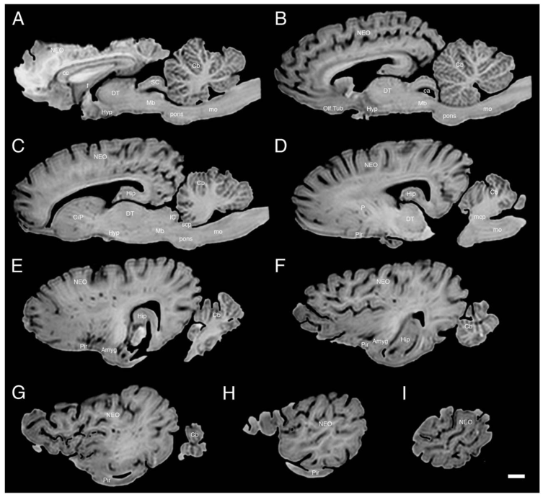
The amygdala occupies the ventral temporal forebrain
The amygdala is a group of nuclei within the temporal forebrain. Bhagwandin and colleagues located an amygdalar complex caudoventral to the putamen in the rhinoceros brains. Caudoventral means toward the rear and underside of the structure being described.
The MRI images distinguished broad cortical and nuclear portions of this region. The reported volumes were 3.10 cm³ in the black rhinoceros preparation and 1.67 cm³ in the white rhinoceros preparation. These are measurements from the two individual fixed brains.
Its location places the amygdala near olfactory and temporal structures. That proximity provides anatomical context for studying the significance of social sensory cues. Behavioral evidence for recognizing another animal's sex or familiarity comes from controlled presentations of signals, which complement this structural map.
Bhagwandin et al. (2017), Fig. 5. The amygdala occupies the ventral temporal forebrain.
Bhagwandin et al. (2017)
12
Notes:
• The amygdala is a group of nuclei within the temporal forebrain. Bhagwandin and colleagues located an amygdalar complex caudoventral to the putamen in the rhinoceros brains. Caudoventral means toward the rear and underside of the structure being described.
• The MRI images distinguished broad cortical and nuclear portions of this region. The reported volumes were 3.10 cm³ in the black rhinoceros preparation and 1.67 cm³ in the white rhinoceros preparation. These are measurements from the two individual fixed brains.
• Its location places the amygdala near olfactory and temporal structures. That proximity provides anatomical context for studying the significance of social sensory cues. Behavioral evidence for recognizing another animal's sex or familiarity comes from controlled presentations of signals, which complement this structural map.
• Read the original figure together with the claim. Follow each structure across the labeled views and use the scale bar to relate its position to neighboring tissue. These fixed-brain observations identify anatomical organization; they are complementary to behavioral experiments on live animals.
References:
Bhagwandin A; Haagensen M; Manger PR. (2017). The Brain of the Black (Diceros bicornis) and White (Ceratotherium simum) African Rhinoceroses: Morphology and Volumetrics from Magnetic Resonance Imaging. Frontiers in Neuroanatomy 11:74. https://doi.org/10.3389/fnana.2017.00074
Figure: Bhagwandin et al. (2017), Fig. 5. The amygdala occupies the ventral temporal forebrain.
Figure source: https://doi.org/10.3389/fnana.2017.00074

Slide 13
The hippocampus curves around the diencephalon
The hippocampus is a curved temporal forebrain structure involved in memory in mammals. The rhinoceros hippocampus begins behind the amygdalar region, rises alongside the lateral ventricle, and curves dorsally toward the diencephalon. Serial MRI sections reveal this changing position.
The fornix is an axon bundle associated with hippocampal output. The investigators followed its anatomical relationship toward the mammillary region of the hypothalamus. This links the curved temporal structure to a recognizable ventral forebrain destination.
Measured hippocampal volumes were 4.71 cm³ and 3.97 cm³ in the black and white rhinoceros preparations. Those measurements describe tissue size, while experiments on dung and calls investigate recognition behavior. Together, structural mapping and signal presentation identify complementary levels at which social information can be studied.
Bhagwandin et al. (2017), Fig. 5. The hippocampus curves around the diencephalon.
Bhagwandin et al. (2017)
13
Notes:
• The hippocampus is a curved temporal forebrain structure involved in memory in mammals. The rhinoceros hippocampus begins behind the amygdalar region, rises alongside the lateral ventricle, and curves dorsally toward the diencephalon. Serial MRI sections reveal this changing position.
• The fornix is an axon bundle associated with hippocampal output. The investigators followed its anatomical relationship toward the mammillary region of the hypothalamus. This links the curved temporal structure to a recognizable ventral forebrain destination.
• Measured hippocampal volumes were 4.71 cm³ and 3.97 cm³ in the black and white rhinoceros preparations. Those measurements describe tissue size, while experiments on dung and calls investigate recognition behavior. Together, structural mapping and signal presentation identify complementary levels at which social information can be studied.
• Read the original figure together with the claim. Follow each structure across the labeled views and use the scale bar to relate its position to neighboring tissue. These fixed-brain observations identify anatomical organization; they are complementary to behavioral experiments on live animals.
References:
Bhagwandin A; Haagensen M; Manger PR. (2017). The Brain of the Black (Diceros bicornis) and White (Ceratotherium simum) African Rhinoceroses: Morphology and Volumetrics from Magnetic Resonance Imaging. Frontiers in Neuroanatomy 11:74. https://doi.org/10.3389/fnana.2017.00074
Figure: Bhagwandin et al. (2017), Fig. 5. The hippocampus curves around the diencephalon.
Figure source: https://doi.org/10.3389/fnana.2017.00074

Slide 14
Thalamus and hypothalamus occupy neighboring positions
The diencephalon is the central forebrain region containing the thalamus and hypothalamus. In the rhinoceros MRI study, the thalamus forms a prominent gray-matter mass near the third ventricle. An interthalamic adhesion joins tissue across the midline.
The hypothalamus lies below the thalamus, along the ventral part of the third ventricle. The mammillary region forms a recognizable posterior landmark. The anatomy therefore separates a dorsal thalamic territory from a ventral hypothalamic territory within the same central brain region.
This distinction matters when connecting sensory processing with reproductive and social behavior. Identifying the position of a region is different from measuring its activity during a particular response. The MRI supplies the map on which physiological studies of sensory relay, bodily state, and behavioral regulation could be located.
Bhagwandin et al. (2017), Fig. 5. Thalamus and hypothalamus occupy neighboring positions.
Bhagwandin et al. (2017)
14
Notes:
• The diencephalon is the central forebrain region containing the thalamus and hypothalamus. In the rhinoceros MRI study, the thalamus forms a prominent gray-matter mass near the third ventricle. An interthalamic adhesion joins tissue across the midline.
• The hypothalamus lies below the thalamus, along the ventral part of the third ventricle. The mammillary region forms a recognizable posterior landmark. The anatomy therefore separates a dorsal thalamic territory from a ventral hypothalamic territory within the same central brain region.
• This distinction matters when connecting sensory processing with reproductive and social behavior. Identifying the position of a region is different from measuring its activity during a particular response. The MRI supplies the map on which physiological studies of sensory relay, bodily state, and behavioral regulation could be located.
• Read the original figure together with the claim. Follow each structure across the labeled views and use the scale bar to relate its position to neighboring tissue. These fixed-brain observations identify anatomical organization; they are complementary to behavioral experiments on live animals.
References:
Bhagwandin A; Haagensen M; Manger PR. (2017). The Brain of the Black (Diceros bicornis) and White (Ceratotherium simum) African Rhinoceroses: Morphology and Volumetrics from Magnetic Resonance Imaging. Frontiers in Neuroanatomy 11:74. https://doi.org/10.3389/fnana.2017.00074
Figure: Bhagwandin et al. (2017), Fig. 5. Thalamus and hypothalamus occupy neighboring positions.
Figure source: https://doi.org/10.3389/fnana.2017.00074

Slide 15
Midbrain landmarks identify auditory-related territory
The rhinoceros sections reveal the inferior colliculus, a dorsal midbrain structure belonging to the mammalian auditory pathway. It lies near the superior colliculus, a neighboring structure associated with orienting to sensory events. The two paired elevations provide landmarks on the dorsal midbrain.
The cerebral aqueduct is a narrow channel connecting ventricular spaces through the midbrain. Gray matter around it forms the periaqueductal region. The cerebral peduncles, containing major descending axon pathways, occupy a more ventral position.
These landmarks place auditory-related and movement-related structures within the same brainstem level. A rhinoceros orienting toward a call changes its head position before it may approach or run. Playback studies measure those successive actions, while the anatomical sections identify the regions surrounding the pathways that can support them.
Bhagwandin et al. (2017), Fig. 6. Midbrain landmarks identify auditory-related territory.
Bhagwandin et al. (2017)
15
Notes:
• The rhinoceros sections reveal the inferior colliculus, a dorsal midbrain structure belonging to the mammalian auditory pathway. It lies near the superior colliculus, a neighboring structure associated with orienting to sensory events. The two paired elevations provide landmarks on the dorsal midbrain.
• The cerebral aqueduct is a narrow channel connecting ventricular spaces through the midbrain. Gray matter around it forms the periaqueductal region. The cerebral peduncles, containing major descending axon pathways, occupy a more ventral position.
• These landmarks place auditory-related and movement-related structures within the same brainstem level. A rhinoceros orienting toward a call changes its head position before it may approach or run. Playback studies measure those successive actions, while the anatomical sections identify the regions surrounding the pathways that can support them.
• Read the original figure together with the claim. Follow each structure across the labeled views and use the scale bar to relate its position to neighboring tissue. These fixed-brain observations identify anatomical organization; they are complementary to behavioral experiments on live animals.
References:
Bhagwandin A; Haagensen M; Manger PR. (2017). The Brain of the Black (Diceros bicornis) and White (Ceratotherium simum) African Rhinoceroses: Morphology and Volumetrics from Magnetic Resonance Imaging. Frontiers in Neuroanatomy 11:74. https://doi.org/10.3389/fnana.2017.00074
Figure: Bhagwandin et al. (2017), Fig. 6. Midbrain landmarks identify auditory-related territory.
Figure source: https://doi.org/10.3389/fnana.2017.00074

Slide 16
The cerebellum is connected to the brainstem
The cerebellum is a hindbrain structure linked to coordination and adjustment of movement in mammals. The rhinoceros photographs show tightly packed folia, the narrow folds of its cortical surface. The central vermis and lateral cerebellar regions are visible beneath the cerebral hemispheres.
MRI also identifies the middle cerebellar peduncles, bundles connecting the cerebellum with the brainstem. Measured cerebellar volumes were 37.73 cm³ in the black rhinoceros and 44.50 cm³ in the white rhinoceros preparation. These values describe the tissue captured in each fixed specimen.
Orienting the head, stepping toward a signal, and altering direction require coordinated movement. The cerebellum's position and connections provide the anatomical context for such control. The social experiments quantify the resulting actions, including vigilance, walking, running, and investigation at a midden.
Bhagwandin et al. (2017), Fig. 2. The cerebellum is connected to the brainstem.
Bhagwandin et al. (2017)
16
Notes:
• The cerebellum is a hindbrain structure linked to coordination and adjustment of movement in mammals. The rhinoceros photographs show tightly packed folia, the narrow folds of its cortical surface. The central vermis and lateral cerebellar regions are visible beneath the cerebral hemispheres.
• MRI also identifies the middle cerebellar peduncles, bundles connecting the cerebellum with the brainstem. Measured cerebellar volumes were 37.73 cm³ in the black rhinoceros and 44.50 cm³ in the white rhinoceros preparation. These values describe the tissue captured in each fixed specimen.
• Orienting the head, stepping toward a signal, and altering direction require coordinated movement. The cerebellum's position and connections provide the anatomical context for such control. The social experiments quantify the resulting actions, including vigilance, walking, running, and investigation at a midden.
• Read the original figure together with the claim. Follow each structure across the labeled views and use the scale bar to relate its position to neighboring tissue. These fixed-brain observations identify anatomical organization; they are complementary to behavioral experiments on live animals.
References:
Bhagwandin A; Haagensen M; Manger PR. (2017). The Brain of the Black (Diceros bicornis) and White (Ceratotherium simum) African Rhinoceroses: Morphology and Volumetrics from Magnetic Resonance Imaging. Frontiers in Neuroanatomy 11:74. https://doi.org/10.3389/fnana.2017.00074
Figure: Bhagwandin et al. (2017), Fig. 2. The cerebellum is connected to the brainstem.
Figure source: https://doi.org/10.3389/fnana.2017.00074

Slide 17
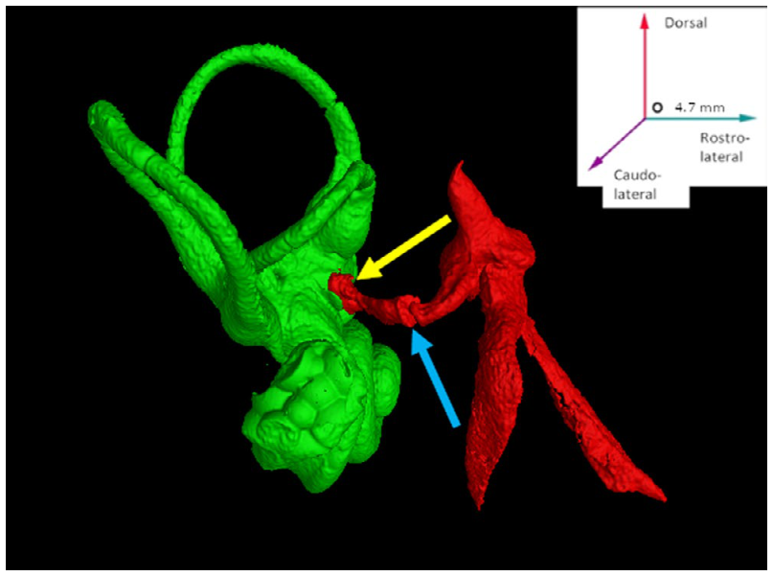
Micro-CT resolves the ear's linked mechanical structures
Robert and colleagues examined four temporal bones from two one-day-old southern white rhinoceros calves. Micro-computed tomography, or micro-CT, reconstructs internal structures from X-ray measurements at high spatial resolution. The scans used an average voxel edge length of approximately 39.5 µm.
A voxel is a three-dimensional image element. Differences among bone, air spaces, and softer contents allowed the investigators to identify the auditory ossicles and the bony inner ear. The published colored reconstructions distinguish these structures without changing their physical arrangement.
The resulting images follow a mechanical sequence from the middle ear to the vestibule and cochlea. This is the apparatus that delivers airborne sound to the inner ear. It also contains separate structures for sensing head movement, making hearing and balance anatomically adjacent systems.
Robert et al. (2021), Fig. 6. Micro-CT resolves the ear's linked mechanical structures.
Robert et al. (2021)
17
Notes:
• Robert and colleagues examined four temporal bones from two one-day-old southern white rhinoceros calves. Micro-computed tomography, or micro-CT, reconstructs internal structures from X-ray measurements at high spatial resolution. The scans used an average voxel edge length of approximately 39.5 µm.
• A voxel is a three-dimensional image element. Differences among bone, air spaces, and softer contents allowed the investigators to identify the auditory ossicles and the bony inner ear. The published colored reconstructions distinguish these structures without changing their physical arrangement.
• The resulting images follow a mechanical sequence from the middle ear to the vestibule and cochlea. This is the apparatus that delivers airborne sound to the inner ear. It also contains separate structures for sensing head movement, making hearing and balance anatomically adjacent systems.
• Read the original figure together with the claim. Trace the connected structures in the published reconstruction. The color belongs to the original micro-CT figure. The preparation consists of neonatal temporal bones, so the dimensions describe those specimens rather than an adult hearing threshold.
References:
Robert MP; Carstens A; de Beer FC; Hoffman JW; Steenkamp G. (2021). Micro‐anatomy of the ear of the southern white rhinoceros (Ceratotherium simum simum). Anatomia, Histologia, Embryologia 50:316-323. https://doi.org/10.1111/ahe.12632
Figure: Robert et al. (2021), Fig. 6. Micro-CT resolves the ear's linked mechanical structures.
Figure source: https://doi.org/10.1111/ahe.12632

Slide 18
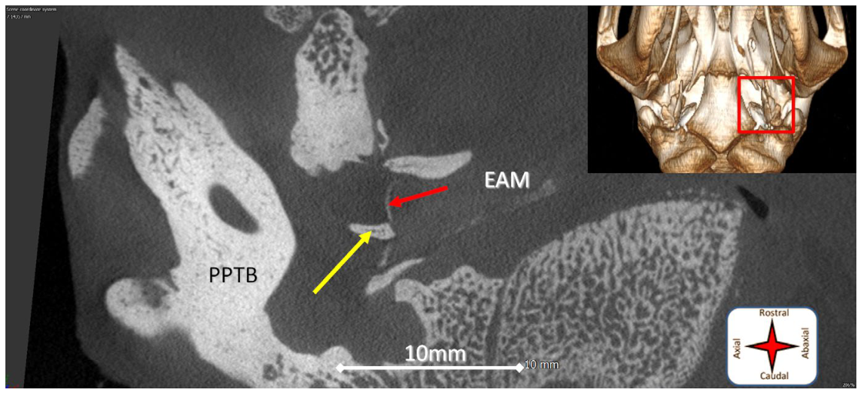
The tympanic membrane couples sound to the malleus
The tympanic membrane, or eardrum, forms the boundary between the external ear canal and the middle ear. The white rhinoceros micro-CT study shows the malleus attached to this membrane by its handle, called the manubrium. This attachment couples membrane motion to an auditory ossicle.
An ossicle is one of the small middle-ear bones transmitting mechanical movement. The images identify the external acoustic meatus, the passage leading toward the membrane, and the neighboring tympanic cavity. The scale bar makes their spatial relationship explicit.
Sound arriving through the canal sets the membrane into motion. The attached malleus begins the mechanical chain that continues through the incus and stapes toward the inner ear. The anatomy explains the route of sound transmission before any auditory nerve signal can arise.
Robert et al. (2021), Fig. 1. The tympanic membrane couples sound to the malleus.
Robert et al. (2021)
18
Notes:
• The tympanic membrane, or eardrum, forms the boundary between the external ear canal and the middle ear. The white rhinoceros micro-CT study shows the malleus attached to this membrane by its handle, called the manubrium. This attachment couples membrane motion to an auditory ossicle.
• An ossicle is one of the small middle-ear bones transmitting mechanical movement. The images identify the external acoustic meatus, the passage leading toward the membrane, and the neighboring tympanic cavity. The scale bar makes their spatial relationship explicit.
• Sound arriving through the canal sets the membrane into motion. The attached malleus begins the mechanical chain that continues through the incus and stapes toward the inner ear. The anatomy explains the route of sound transmission before any auditory nerve signal can arise.
• Read the original figure together with the claim. Trace the connected structures in the published reconstruction. The color belongs to the original micro-CT figure. The preparation consists of neonatal temporal bones, so the dimensions describe those specimens rather than an adult hearing threshold.
References:
Robert MP; Carstens A; de Beer FC; Hoffman JW; Steenkamp G. (2021). Micro‐anatomy of the ear of the southern white rhinoceros (Ceratotherium simum simum). Anatomia, Histologia, Embryologia 50:316-323. https://doi.org/10.1111/ahe.12632
Figure: Robert et al. (2021), Fig. 1. The tympanic membrane couples sound to the malleus.
Figure source: https://doi.org/10.1111/ahe.12632

Slide 19
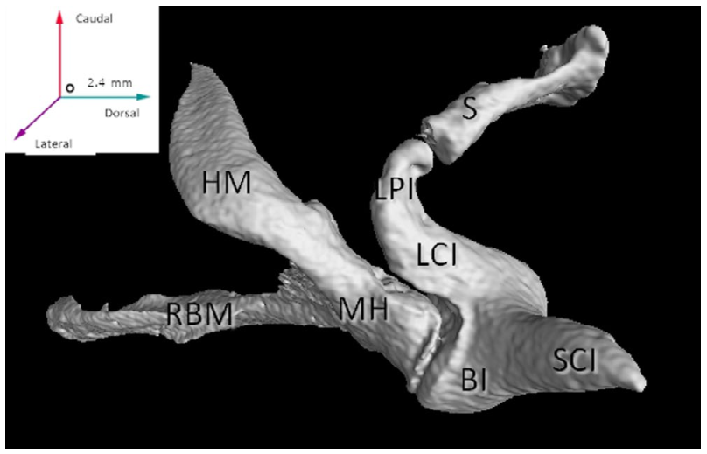
A branched malleus begins the ossicular chain
The rhinoceros malleus has a conspicuous branched configuration. Its head articulates with the incus, while its manubrium attaches to the tympanic membrane. Articulation means the meeting of two bones at a joint, allowing force and motion to pass between them.
Robert and colleagues described a long rostral branch contributing to the malleus's characteristic shape. The micro-CT reconstruction retains the positions of the bones relative to one another. This prevents the isolated shape of a bone from being mistaken for its role in the assembled ear.
The ossicles operate as a connected mechanical chain. Movement initiated at the eardrum reaches the incus through the malleus's joint, then reaches the stapes. Their geometry establishes the route of transmission; measuring its frequency-dependent effectiveness would require physiological testing in addition to structural imaging.
Robert et al. (2021), Fig. 3. A branched malleus begins the ossicular chain.
Robert et al. (2021), Fig. 6. Ossicles positioned beside the bony labyrinth.
Robert et al. (2021)
19
Notes:
• The rhinoceros malleus has a conspicuous branched configuration. Its head articulates with the incus, while its manubrium attaches to the tympanic membrane. Articulation means the meeting of two bones at a joint, allowing force and motion to pass between them.
• Robert and colleagues described a long rostral branch contributing to the malleus's characteristic shape. The micro-CT reconstruction retains the positions of the bones relative to one another. This prevents the isolated shape of a bone from being mistaken for its role in the assembled ear.
• The ossicles operate as a connected mechanical chain. Movement initiated at the eardrum reaches the incus through the malleus's joint, then reaches the stapes. Their geometry establishes the route of transmission; measuring its frequency-dependent effectiveness would require physiological testing in addition to structural imaging.
• Read the original figure together with the claim. Trace the connected structures in the published reconstruction. The color belongs to the original micro-CT figure. The preparation consists of neonatal temporal bones, so the dimensions describe those specimens rather than an adult hearing threshold.
References:
Robert MP; Carstens A; de Beer FC; Hoffman JW; Steenkamp G. (2021). Micro‐anatomy of the ear of the southern white rhinoceros (Ceratotherium simum simum). Anatomia, Histologia, Embryologia 50:316-323. https://doi.org/10.1111/ahe.12632
Figure: Robert et al. (2021), Fig. 3. A branched malleus begins the ossicular chain.
Figure source: https://doi.org/10.1111/ahe.12632
Figure: Robert et al. (2021), Fig. 6. Ossicles positioned beside the bony labyrinth.
Figure source: https://doi.org/10.1111/ahe.12632

Slide 20
The stapes delivers motion at the oval window
The incus links the malleus to the stapes through its long process. At its tip, the lenticular process contacts the head of the stapes. The white rhinoceros reconstruction shows these joints in relation to the bony inner ear.
The stapes has a footplate positioned at the oval window, an opening into the vestibular region of the inner ear. Motion transmitted through the ossicular chain therefore reaches a boundary between the air-filled middle ear and the fluid-containing inner ear.
This arrangement converts eardrum motion into movement at an inner-ear window. The neighboring round window provides another boundary of the cochlear fluid spaces. The spatial relationship between the two windows is part of the mechanical organization supporting sound transmission into the cochlea.
Robert et al. (2021), Fig. 6. The stapes delivers motion at the oval window.
Robert et al. (2021)
20
Notes:
• The incus links the malleus to the stapes through its long process. At its tip, the lenticular process contacts the head of the stapes. The white rhinoceros reconstruction shows these joints in relation to the bony inner ear.
• The stapes has a footplate positioned at the oval window, an opening into the vestibular region of the inner ear. Motion transmitted through the ossicular chain therefore reaches a boundary between the air-filled middle ear and the fluid-containing inner ear.
• This arrangement converts eardrum motion into movement at an inner-ear window. The neighboring round window provides another boundary of the cochlear fluid spaces. The spatial relationship between the two windows is part of the mechanical organization supporting sound transmission into the cochlea.
• Read the original figure together with the claim. Trace the connected structures in the published reconstruction. The color belongs to the original micro-CT figure. The preparation consists of neonatal temporal bones, so the dimensions describe those specimens rather than an adult hearing threshold.
References:
Robert MP; Carstens A; de Beer FC; Hoffman JW; Steenkamp G. (2021). Micro‐anatomy of the ear of the southern white rhinoceros (Ceratotherium simum simum). Anatomia, Histologia, Embryologia 50:316-323. https://doi.org/10.1111/ahe.12632
Figure: Robert et al. (2021), Fig. 6. The stapes delivers motion at the oval window.
Figure source: https://doi.org/10.1111/ahe.12632

Slide 21
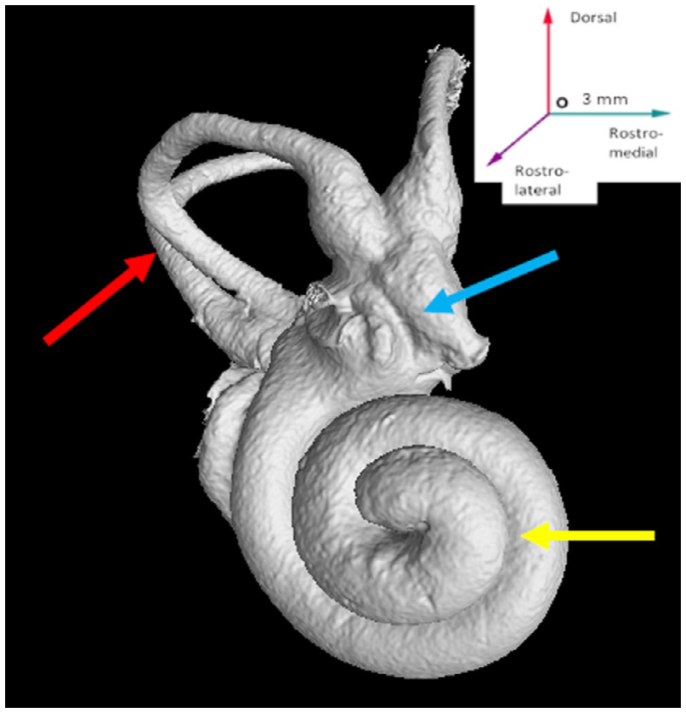
The cochlea coils through two turns
The cochlea is the spiral-shaped hearing component of the inner ear. The white rhinoceros micro-CT study described approximately two turns. Its position is rostrolateral to the vestibule, while the semicircular canals extend dorsocaudally from the same central region.
The reconstruction traces the coil as a continuous bony structure rather than separate chambers. The basal turn lies near the windows receiving mechanical input from the middle ear. More distal turns continue around the central axis of the cochlea.
A coiled arrangement packages an extended sensory apparatus into the temporal bone. The rhinoceros study establishes that geometry, while its scans do not resolve the cellular machinery of auditory transduction. The subsequent identification of internal ducts and bony partitions explains how the coil is subdivided.
Robert et al. (2021), Fig. 7. The cochlea coils through two turns.
Robert et al. (2021)
21
Notes:
• The cochlea is the spiral-shaped hearing component of the inner ear. The white rhinoceros micro-CT study described approximately two turns. Its position is rostrolateral to the vestibule, while the semicircular canals extend dorsocaudally from the same central region.
• The reconstruction traces the coil as a continuous bony structure rather than separate chambers. The basal turn lies near the windows receiving mechanical input from the middle ear. More distal turns continue around the central axis of the cochlea.
• A coiled arrangement packages an extended sensory apparatus into the temporal bone. The rhinoceros study establishes that geometry, while its scans do not resolve the cellular machinery of auditory transduction. The subsequent identification of internal ducts and bony partitions explains how the coil is subdivided.
• Read the original figure together with the claim. Trace the connected structures in the published reconstruction. The color belongs to the original micro-CT figure. The preparation consists of neonatal temporal bones, so the dimensions describe those specimens rather than an adult hearing threshold.
References:
Robert MP; Carstens A; de Beer FC; Hoffman JW; Steenkamp G. (2021). Micro‐anatomy of the ear of the southern white rhinoceros (Ceratotherium simum simum). Anatomia, Histologia, Embryologia 50:316-323. https://doi.org/10.1111/ahe.12632
Figure: Robert et al. (2021), Fig. 7. The cochlea coils through two turns.
Figure source: https://doi.org/10.1111/ahe.12632

Slide 22
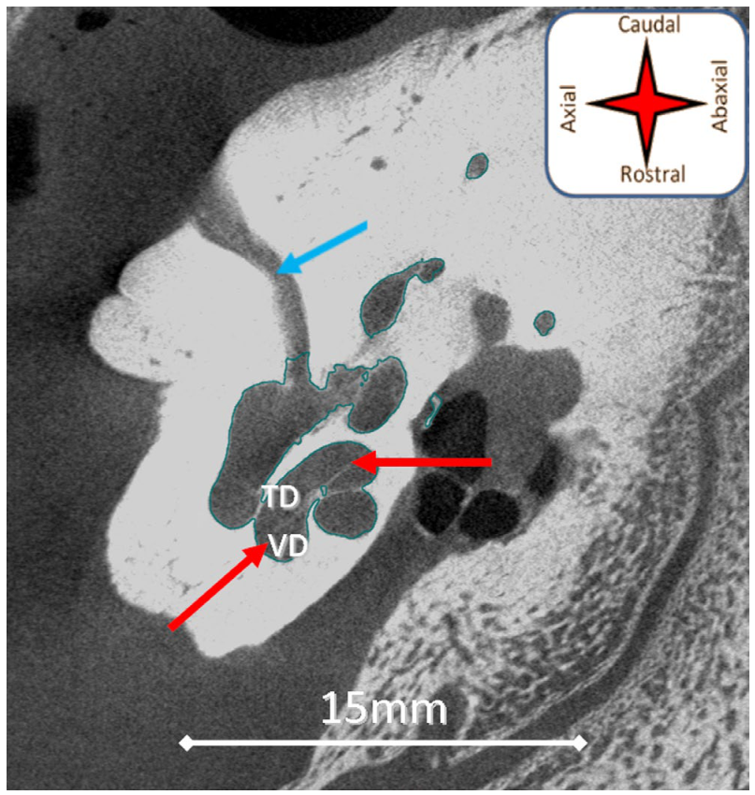
Bony partitions distinguish the cochlear fluid passages
Within the cochlea, Robert and colleagues identified the tympanic and vestibular ducts and the osseous spiral lamina. Osseous means formed of bone; a lamina is a thin plate. The spiral lamina projects into the cochlear space and helps organize its internal divisions.
The published micro-CT image follows these structures around the coil. It also marks the cochlear aqueduct, a small bony channel extending toward the posterior cranial cavity. Colored arrows identify structures in the original article rather than adding new explanatory graphics.
These partitions distinguish the route taken by fluid displacement from the surrounding bony enclosure. Sound transmission therefore depends on organized spaces within the cochlea, not simply on the presence of a spiral shell. The visible anatomy explains how separate passages coexist inside the same compact structure.
Robert et al. (2021), Fig. 8. Bony partitions distinguish the cochlear fluid passages.
Robert et al. (2021)
22
Notes:
• Within the cochlea, Robert and colleagues identified the tympanic and vestibular ducts and the osseous spiral lamina. Osseous means formed of bone; a lamina is a thin plate. The spiral lamina projects into the cochlear space and helps organize its internal divisions.
• The published micro-CT image follows these structures around the coil. It also marks the cochlear aqueduct, a small bony channel extending toward the posterior cranial cavity. Colored arrows identify structures in the original article rather than adding new explanatory graphics.
• These partitions distinguish the route taken by fluid displacement from the surrounding bony enclosure. Sound transmission therefore depends on organized spaces within the cochlea, not simply on the presence of a spiral shell. The visible anatomy explains how separate passages coexist inside the same compact structure.
• Read the original figure together with the claim. Trace the connected structures in the published reconstruction. The color belongs to the original micro-CT figure. The preparation consists of neonatal temporal bones, so the dimensions describe those specimens rather than an adult hearing threshold.
References:
Robert MP; Carstens A; de Beer FC; Hoffman JW; Steenkamp G. (2021). Micro‐anatomy of the ear of the southern white rhinoceros (Ceratotherium simum simum). Anatomia, Histologia, Embryologia 50:316-323. https://doi.org/10.1111/ahe.12632
Figure: Robert et al. (2021), Fig. 8. Bony partitions distinguish the cochlear fluid passages.
Figure source: https://doi.org/10.1111/ahe.12632

Slide 23
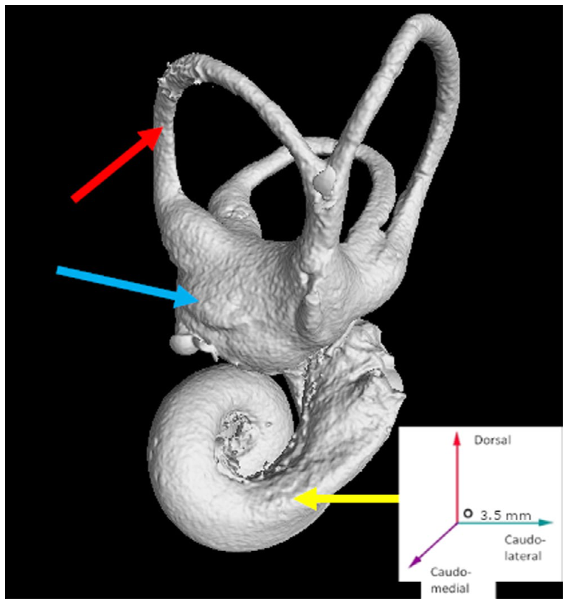
The vestibule connects hearing and balance structures
The vestibule is the central bony inner-ear space between the cochlea and semicircular canals. The stapes footplate contacts its oval-window boundary. In the rhinoceros reconstruction, the cochlea extends from one side while the canals occupy the dorsal and caudal region.
This central position makes the vestibule a useful landmark when reading different views. The same structure appears beside the cochlear base in one orientation and beneath the canal system in another. Comparing views prevents a change in perspective from being mistaken for a different anatomical connection.
Hearing and balance use neighboring inner-ear components for different sensory functions. Their shared enclosure reflects anatomical integration, while their sensory inputs concern different physical events. Sound-related pressure changes and head motion must ultimately be represented by distinct afferent pathways.
Robert et al. (2021), Fig. 10. The vestibule connects hearing and balance structures.
Robert et al. (2021)
23
Notes:
• The vestibule is the central bony inner-ear space between the cochlea and semicircular canals. The stapes footplate contacts its oval-window boundary. In the rhinoceros reconstruction, the cochlea extends from one side while the canals occupy the dorsal and caudal region.
• This central position makes the vestibule a useful landmark when reading different views. The same structure appears beside the cochlear base in one orientation and beneath the canal system in another. Comparing views prevents a change in perspective from being mistaken for a different anatomical connection.
• Hearing and balance use neighboring inner-ear components for different sensory functions. Their shared enclosure reflects anatomical integration, while their sensory inputs concern different physical events. Sound-related pressure changes and head motion must ultimately be represented by distinct afferent pathways.
• Read the original figure together with the claim. Trace the connected structures in the published reconstruction. The color belongs to the original micro-CT figure. The preparation consists of neonatal temporal bones, so the dimensions describe those specimens rather than an adult hearing threshold.
References:
Robert MP; Carstens A; de Beer FC; Hoffman JW; Steenkamp G. (2021). Micro‐anatomy of the ear of the southern white rhinoceros (Ceratotherium simum simum). Anatomia, Histologia, Embryologia 50:316-323. https://doi.org/10.1111/ahe.12632
Figure: Robert et al. (2021), Fig. 10. The vestibule connects hearing and balance structures.
Figure source: https://doi.org/10.1111/ahe.12632

Slide 24
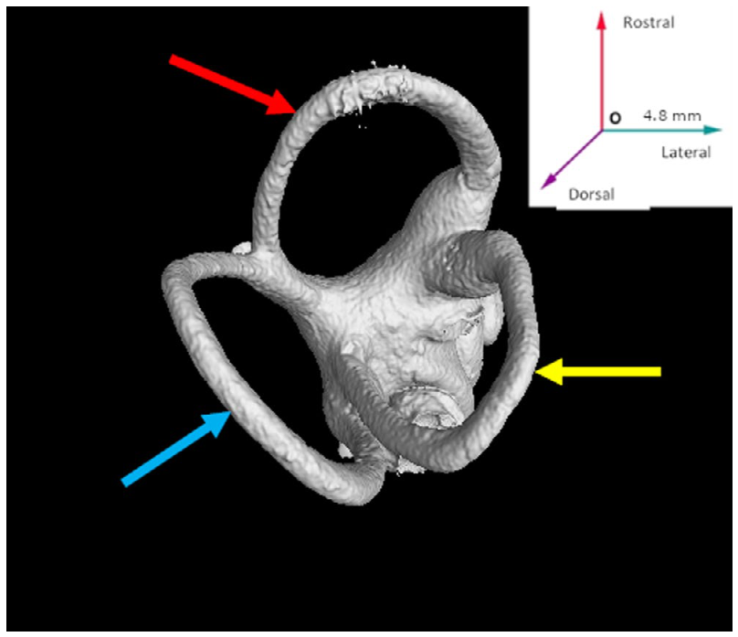
Three semicircular canals sample different motion planes
The rhinoceros bony labyrinth contains anterior, posterior, and lateral semicircular canals. These curved structures occupy different orientations, supporting the mammalian organization for detecting rotation of the head. Their spatial separation is visible in the dorsal reconstruction.
The anterior and posterior canals join through a common crus, a shared segment returning toward the vestibule. The lateral canal has a separate course. Enlarged regions called ampullae were visible at the ends of the anterior and posterior canals in the anatomical study.
Different canal orientations allow head movement to be sampled along different planes. A rhinoceros turning toward a sound simultaneously changes its auditory sampling direction and its head-motion input. The canal arrangement provides the structural context for maintaining orientation during that movement.
Robert et al. (2021), Fig. 11. Three semicircular canals sample different motion planes.
Robert et al. (2021)
24
Notes:
• The rhinoceros bony labyrinth contains anterior, posterior, and lateral semicircular canals. These curved structures occupy different orientations, supporting the mammalian organization for detecting rotation of the head. Their spatial separation is visible in the dorsal reconstruction.
• The anterior and posterior canals join through a common crus, a shared segment returning toward the vestibule. The lateral canal has a separate course. Enlarged regions called ampullae were visible at the ends of the anterior and posterior canals in the anatomical study.
• Different canal orientations allow head movement to be sampled along different planes. A rhinoceros turning toward a sound simultaneously changes its auditory sampling direction and its head-motion input. The canal arrangement provides the structural context for maintaining orientation during that movement.
• Read the original figure together with the claim. Trace the connected structures in the published reconstruction. The color belongs to the original micro-CT figure. The preparation consists of neonatal temporal bones, so the dimensions describe those specimens rather than an adult hearing threshold.
References:
Robert MP; Carstens A; de Beer FC; Hoffman JW; Steenkamp G. (2021). Micro‐anatomy of the ear of the southern white rhinoceros (Ceratotherium simum simum). Anatomia, Histologia, Embryologia 50:316-323. https://doi.org/10.1111/ahe.12632
Figure: Robert et al. (2021), Fig. 11. Three semicircular canals sample different motion planes.
Figure source: https://doi.org/10.1111/ahe.12632

Slide 25
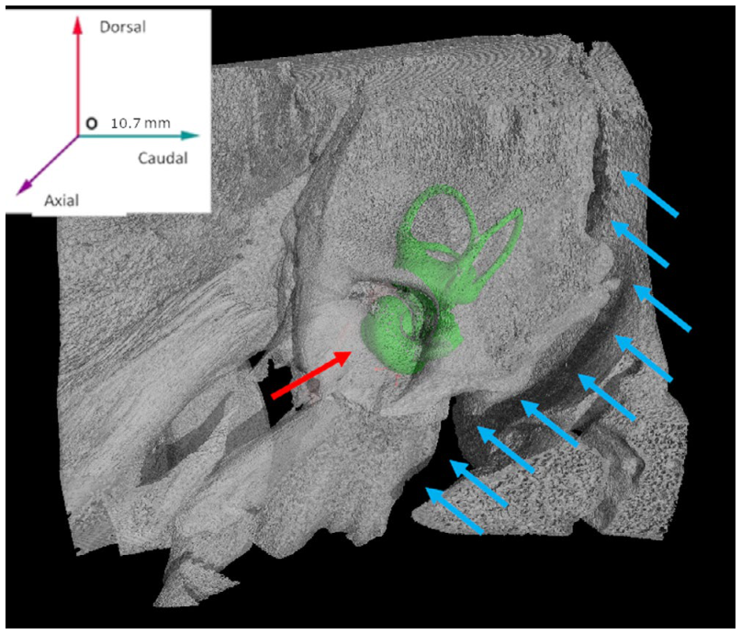
A bony passage links the inner ear to cranial nerves
The internal acoustic meatus is a passage through the temporal bone associated with the facial and vestibulocochlear nerves. The published rhinoceros reconstruction shows its position beside the inner ear. The vestibulocochlear nerve carries information associated with hearing and balance.
Robert and colleagues used the bony openings and neighboring structures to describe these routes. The mean reconstructed bony inner-ear volume was 224.41 mm³, while the ossicles together occupied approximately 32.97 mm³. These measurements distinguish the enclosed sensory apparatus from its mechanical input chain.
The anatomical sequence now extends from the external canal through the ossicles, into the cochlea and vestibular structures, and toward a cranial-nerve passage. This identifies how peripheral sound and motion information can reach the brainstem. Playback experiments investigate how the animal then uses an acoustic signal.
Robert et al. (2021), Fig. 12. A bony passage links the inner ear to cranial nerves.
Robert et al. (2021)
25
Notes:
• The internal acoustic meatus is a passage through the temporal bone associated with the facial and vestibulocochlear nerves. The published rhinoceros reconstruction shows its position beside the inner ear. The vestibulocochlear nerve carries information associated with hearing and balance.
• Robert and colleagues used the bony openings and neighboring structures to describe these routes. The mean reconstructed bony inner-ear volume was 224.41 mm³, while the ossicles together occupied approximately 32.97 mm³. These measurements distinguish the enclosed sensory apparatus from its mechanical input chain.
• The anatomical sequence now extends from the external canal through the ossicles, into the cochlea and vestibular structures, and toward a cranial-nerve passage. This identifies how peripheral sound and motion information can reach the brainstem. Playback experiments investigate how the animal then uses an acoustic signal.
• Read the original figure together with the claim. Trace the connected structures in the published reconstruction. The color belongs to the original micro-CT figure. The preparation consists of neonatal temporal bones, so the dimensions describe those specimens rather than an adult hearing threshold.
References:
Robert MP; Carstens A; de Beer FC; Hoffman JW; Steenkamp G. (2021). Micro‐anatomy of the ear of the southern white rhinoceros (Ceratotherium simum simum). Anatomia, Histologia, Embryologia 50:316-323. https://doi.org/10.1111/ahe.12632
Figure: Robert et al. (2021), Fig. 12. A bony passage links the inner ear to cranial nerves.
Figure source: https://doi.org/10.1111/ahe.12632

Slide 26
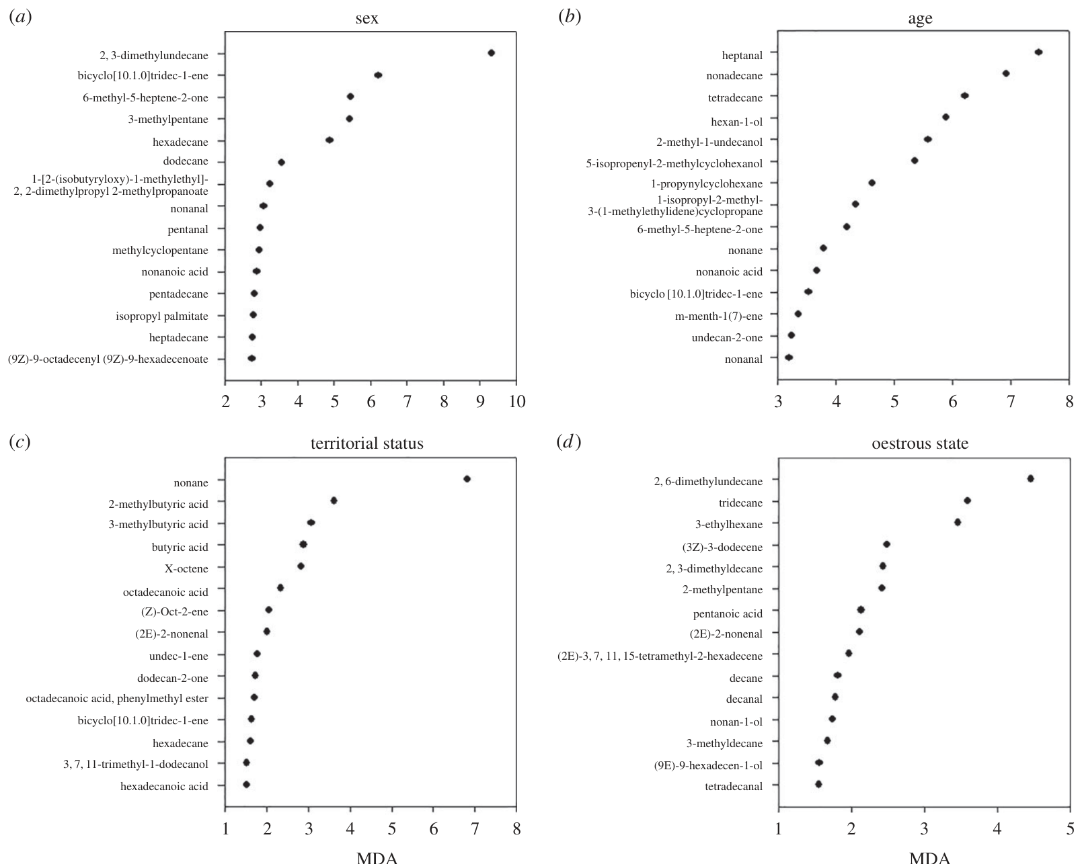
Fresh dung releases a diverse chemical mixture
Marneweck and colleagues sampled volatile compounds released by freshly deposited white rhinoceros dung. A volatile compound enters the air sufficiently readily to contribute to an odor mixture. Fresh samples of approximately 800 g were collected within 5 minutes of defecation.
Air was drawn over each sample for 25 minutes at 150 mL/min and the compounds were trapped for analysis. Gas chromatography–mass spectrometry separates compounds and helps identify them through their mass spectra. The study detected 225 volatile compounds belonging to 13 chemical groups.
The emitted odor is therefore a mixture rather than a single universal rhinoceros signal. Differences among mixtures can carry information about their producers. The investigators next related chemical composition to known sex, age, territorial status, and reproductive condition, connecting measured emissions to socially relevant categories.
Marneweck et al. (2017), Fig. 1. Fresh dung releases a diverse chemical mixture.
Marneweck et al. (2017)
26
Notes:
• Marneweck and colleagues sampled volatile compounds released by freshly deposited white rhinoceros dung. A volatile compound enters the air sufficiently readily to contribute to an odor mixture. Fresh samples of approximately 800 g were collected within 5 minutes of defecation.
• Air was drawn over each sample for 25 minutes at 150 mL/min and the compounds were trapped for analysis. Gas chromatography–mass spectrometry separates compounds and helps identify them through their mass spectra. The study detected 225 volatile compounds belonging to 13 chemical groups.
• The emitted odor is therefore a mixture rather than a single universal rhinoceros signal. Differences among mixtures can carry information about their producers. The investigators next related chemical composition to known sex, age, territorial status, and reproductive condition, connecting measured emissions to socially relevant categories.
• Read the original figure together with the claim. Compare visits, investigation, and vigilance as separate behavioral measurements. The artificial mixtures reproduce a multicomponent odor presentation at a midden; the experiment does not identify a receptor for an isolated molecule.
References:
Marneweck C; Jürgens A; Shrader AM. (2017). Dung odours signal sex, age, territorial and oestrous state in white rhinos. Proceedings of the Royal Society B: Biological Sciences 284:20162376. https://doi.org/10.1098/rspb.2016.2376
Figure: Marneweck et al. (2017), Fig. 1. Fresh dung releases a diverse chemical mixture.
Figure source: https://doi.org/10.1098/rspb.2016.2376

Slide 27
Dung composition varies with sex and age
Chemical profiles differed between male and female white rhinoceroses and among age categories. The compound 2,3-dimethylundecane contributed prominently to discrimination by sex, while heptanal was associated with age. These names identify chemical components within the sampled mixture.
The researchers related measurements from known donors to their biological characteristics. This comparison asks whether information is available in an odor source before asking how a recipient responds to it. The published figure ranks compounds associated with the different donor categories.
A recipient can potentially obtain information without seeing the donor because the deposit persists after defecation. Behavioral tests are needed to connect that chemical variation to an animal's choices. Later experiments demonstrate that sniffing and vigilance depend on the identity category and familiarity of the dung source.
Marneweck et al. (2017), Fig. 1. Dung composition varies with sex and age.
Marneweck et al. (2017)
27
Notes:
• Chemical profiles differed between male and female white rhinoceroses and among age categories. The compound 2,3-dimethylundecane contributed prominently to discrimination by sex, while heptanal was associated with age. These names identify chemical components within the sampled mixture.
• The researchers related measurements from known donors to their biological characteristics. This comparison asks whether information is available in an odor source before asking how a recipient responds to it. The published figure ranks compounds associated with the different donor categories.
• A recipient can potentially obtain information without seeing the donor because the deposit persists after defecation. Behavioral tests are needed to connect that chemical variation to an animal's choices. Later experiments demonstrate that sniffing and vigilance depend on the identity category and familiarity of the dung source.
• Read the original figure together with the claim. Compare visits, investigation, and vigilance as separate behavioral measurements. The artificial mixtures reproduce a multicomponent odor presentation at a midden; the experiment does not identify a receptor for an isolated molecule.
References:
Marneweck C; Jürgens A; Shrader AM. (2017). Dung odours signal sex, age, territorial and oestrous state in white rhinos. Proceedings of the Royal Society B: Biological Sciences 284:20162376. https://doi.org/10.1098/rspb.2016.2376
Figure: Marneweck et al. (2017), Fig. 1. Dung composition varies with sex and age.
Figure source: https://doi.org/10.1098/rspb.2016.2376

Slide 28
Territorial and reproductive states alter dung chemistry
Among male white rhinoceroses, dung chemistry differed with territorial status. Nonane was associated with this distinction. Among females, 2,6-dimethylundecane contributed to differences linked to reproductive condition. An oestrous female is in a reproductive state associated with receptivity to mating.
These associations were identified from naturally emitted mixtures collected from known animals. The chemical comparisons therefore connect bodily and social states to the composition of a deposited signal. They do not require the producer to remain near the midden when another rhinoceros samples it.
The field experiment tested artificial mixtures representing territorial-male and oestrous-female odors. Those mixtures contained several components rather than isolated diagnostic compounds. This distinction matters because the behavioral response demonstrates information in a blend, not a unique receptor mechanism for any one listed chemical.
Marneweck et al. (2017), Fig. 1. Territorial and reproductive states alter dung chemistry.
Marneweck et al. (2017)
28
Notes:
• Among male white rhinoceroses, dung chemistry differed with territorial status. Nonane was associated with this distinction. Among females, 2,6-dimethylundecane contributed to differences linked to reproductive condition. An oestrous female is in a reproductive state associated with receptivity to mating.
• These associations were identified from naturally emitted mixtures collected from known animals. The chemical comparisons therefore connect bodily and social states to the composition of a deposited signal. They do not require the producer to remain near the midden when another rhinoceros samples it.
• The field experiment tested artificial mixtures representing territorial-male and oestrous-female odors. Those mixtures contained several components rather than isolated diagnostic compounds. This distinction matters because the behavioral response demonstrates information in a blend, not a unique receptor mechanism for any one listed chemical.
• Read the original figure together with the claim. Compare visits, investigation, and vigilance as separate behavioral measurements. The artificial mixtures reproduce a multicomponent odor presentation at a midden; the experiment does not identify a receptor for an isolated molecule.
References:
Marneweck C; Jürgens A; Shrader AM. (2017). Dung odours signal sex, age, territorial and oestrous state in white rhinos. Proceedings of the Royal Society B: Biological Sciences 284:20162376. https://doi.org/10.1098/rspb.2016.2376
Figure: Marneweck et al. (2017), Fig. 1. Territorial and reproductive states alter dung chemistry.
Figure source: https://doi.org/10.1098/rspb.2016.2376

Slide 29
Synthetic blends make odor a manipulable field signal
To test receiver behavior, the investigators applied odor mixtures to artificial grass boluses placed at established middens. The boluses measured approximately 150 × 90 × 90 mm. Each was soaked for 1 minute in a solution containing 1 mL of mixture in 1 L of water.
A rival-like mixture was placed near the midden center, and an oestrous-female mixture near its edge, matching typical deposition locations. Water and a generic plant-derived dung odor served as controls. The mixtures reproduced natural-like emissions for approximately 48 hours.
Behavior was monitored for 72 hours, allowing several responses to be measured after deposition. Because location and odor category were paired, the experiment tests an ecologically arranged signal presentation. The manipulation links persistent chemical information to visits, vigilance, and investigation at a shared site.
Marneweck et al. (2017), Fig. 2. Synthetic blends make odor a manipulable field signal.
Marneweck et al. (2017)
29
Notes:
• To test receiver behavior, the investigators applied odor mixtures to artificial grass boluses placed at established middens. The boluses measured approximately 150 × 90 × 90 mm. Each was soaked for 1 minute in a solution containing 1 mL of mixture in 1 L of water.
• A rival-like mixture was placed near the midden center, and an oestrous-female mixture near its edge, matching typical deposition locations. Water and a generic plant-derived dung odor served as controls. The mixtures reproduced natural-like emissions for approximately 48 hours.
• Behavior was monitored for 72 hours, allowing several responses to be measured after deposition. Because location and odor category were paired, the experiment tests an ecologically arranged signal presentation. The manipulation links persistent chemical information to visits, vigilance, and investigation at a shared site.
• Read the original figure together with the claim. Compare visits, investigation, and vigilance as separate behavioral measurements. The artificial mixtures reproduce a multicomponent odor presentation at a midden; the experiment does not identify a receptor for an isolated molecule.
References:
Marneweck C; Jürgens A; Shrader AM. (2017). Dung odours signal sex, age, territorial and oestrous state in white rhinos. Proceedings of the Royal Society B: Biological Sciences 284:20162376. https://doi.org/10.1098/rspb.2016.2376
Figure: Marneweck et al. (2017), Fig. 2. Synthetic blends make odor a manipulable field signal.
Figure source: https://doi.org/10.1098/rspb.2016.2376

Slide 30
Rival-like dung increases territorial monitoring
Territorial males increased visits to a midden after presentation of the rival-like odor blend. They also began vigilance sooner. Vigilance here refers to monitoring the surroundings rather than continuing to inspect the deposited bolus.
The experiment separated this response from defecation and sniffing. Increased visitation therefore indicates altered use of the midden, while shorter vigilance latency indicates a change in the timing of environmental monitoring. Latency is the interval between an event and the beginning of a measured response.
Neither the rival-like nor female-like blend produced the same pattern across every behavior. The controls also failed to reproduce the rival response. A territorial signal can thus increase monitoring without simply increasing all activity, linking the biological category of an odor to a particular defensive behavioral sequence.
Marneweck et al. (2017), Fig. 2. Rival-like dung increases territorial monitoring.
Marneweck et al. (2017)
30
Notes:
• Territorial males increased visits to a midden after presentation of the rival-like odor blend. They also began vigilance sooner. Vigilance here refers to monitoring the surroundings rather than continuing to inspect the deposited bolus.
• The experiment separated this response from defecation and sniffing. Increased visitation therefore indicates altered use of the midden, while shorter vigilance latency indicates a change in the timing of environmental monitoring. Latency is the interval between an event and the beginning of a measured response.
• Neither the rival-like nor female-like blend produced the same pattern across every behavior. The controls also failed to reproduce the rival response. A territorial signal can thus increase monitoring without simply increasing all activity, linking the biological category of an odor to a particular defensive behavioral sequence.
• Read the original figure together with the claim. Compare visits, investigation, and vigilance as separate behavioral measurements. The artificial mixtures reproduce a multicomponent odor presentation at a midden; the experiment does not identify a receptor for an isolated molecule.
References:
Marneweck C; Jürgens A; Shrader AM. (2017). Dung odours signal sex, age, territorial and oestrous state in white rhinos. Proceedings of the Royal Society B: Biological Sciences 284:20162376. https://doi.org/10.1098/rspb.2016.2376
Figure: Marneweck et al. (2017), Fig. 2. Rival-like dung increases territorial monitoring.
Figure source: https://doi.org/10.1098/rspb.2016.2376

Slide 31
Female-like dung prolongs chemical investigation
The oestrous-female odor blend increased territorial males' visits and prolonged sniffing at the artificial bolus. Sniffing places the animal close to the source and supports repeated sampling of its chemical mixture. This differs from shifting attention away from the bolus to monitor the surroundings.
The published experiment measured sniffing duration separately from vigilance latency. Males investigated the female-like presentation for longer, while the rival-like presentation more rapidly elicited vigilance. A single signal site therefore supports different sequences of information gathering.
Defecation did not increase in parallel with these changes. The response reflects selective adjustment of investigation and monitoring rather than a uniform rise in midden activity. Reproductive and territorial information can accordingly influence what the receiver does next, even though both arrive through the same sensory channel.
Marneweck et al. (2017), Fig. 2. Female-like dung prolongs chemical investigation.
Marneweck et al. (2017)
31
Notes:
• The oestrous-female odor blend increased territorial males' visits and prolonged sniffing at the artificial bolus. Sniffing places the animal close to the source and supports repeated sampling of its chemical mixture. This differs from shifting attention away from the bolus to monitor the surroundings.
• The published experiment measured sniffing duration separately from vigilance latency. Males investigated the female-like presentation for longer, while the rival-like presentation more rapidly elicited vigilance. A single signal site therefore supports different sequences of information gathering.
• Defecation did not increase in parallel with these changes. The response reflects selective adjustment of investigation and monitoring rather than a uniform rise in midden activity. Reproductive and territorial information can accordingly influence what the receiver does next, even though both arrive through the same sensory channel.
• Read the original figure together with the claim. Compare visits, investigation, and vigilance as separate behavioral measurements. The artificial mixtures reproduce a multicomponent odor presentation at a midden; the experiment does not identify a receptor for an isolated molecule.
References:
Marneweck C; Jürgens A; Shrader AM. (2017). Dung odours signal sex, age, territorial and oestrous state in white rhinos. Proceedings of the Royal Society B: Biological Sciences 284:20162376. https://doi.org/10.1098/rspb.2016.2376
Figure: Marneweck et al. (2017), Fig. 2. Female-like dung prolongs chemical investigation.
Figure source: https://doi.org/10.1098/rspb.2016.2376

Slide 32
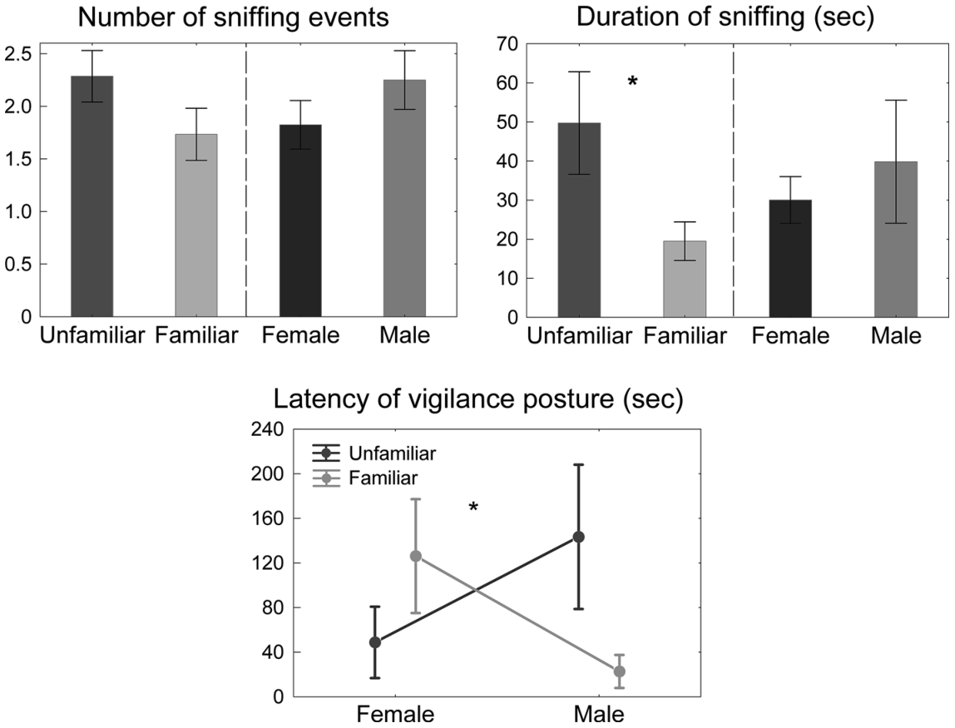
Unfamiliar dung attracts longer investigation
Cinková and Policht tested whether wild southern white rhinoceroses distinguish familiar from unfamiliar dung donors. Familiar donors occupied overlapping ranges; unfamiliar donors came from another reserve. Familiarity therefore concerned prior opportunities for exposure rather than membership in the same immediate group.
The experiment used approximately 2 kg of dung per presentation and recorded behavior during a 5-minute observation. Animals sniffed unfamiliar dung for more than twice as long as familiar dung. The number of sniffing bouts was comparatively similar.
Longer total investigation can arise through extending sampling within bouts rather than simply starting more bouts. The result links a donor's familiarity to the allocation of investigative time. Chemical recognition thus changes the duration of information gathering when the source belongs to a less familiar animal.
Cinková & Policht (2015), Fig. 1. Unfamiliar dung attracts longer investigation.
Cinková & Policht (2015)
32
Notes:
• Cinková and Policht tested whether wild southern white rhinoceroses distinguish familiar from unfamiliar dung donors. Familiar donors occupied overlapping ranges; unfamiliar donors came from another reserve. Familiarity therefore concerned prior opportunities for exposure rather than membership in the same immediate group.
• The experiment used approximately 2 kg of dung per presentation and recorded behavior during a 5-minute observation. Animals sniffed unfamiliar dung for more than twice as long as familiar dung. The number of sniffing bouts was comparatively similar.
• Longer total investigation can arise through extending sampling within bouts rather than simply starting more bouts. The result links a donor's familiarity to the allocation of investigative time. Chemical recognition thus changes the duration of information gathering when the source belongs to a less familiar animal.
• Read the original figure together with the claim. Compare the donor categories in the same panel before relating them to the recipient behavior. Familiarity was defined by overlapping ranges, so it concerns opportunities for prior exposure rather than confirmed recognition of one uniquely named individual.
References:
Cinková I; Policht R. (2015). Discrimination of familiarity and sex from chemical cues in the dung by wild southern white rhinoceros. Animal Cognition 18:385-392. https://doi.org/10.1007/s10071-014-0810-8
Figure: Cinková & Policht (2015), Fig. 1. Unfamiliar dung attracts longer investigation.
Figure source: https://doi.org/10.1007/s10071-014-0810-8

Slide 33
Sex and familiarity jointly shape vigilance timing
The dung experiment also measured how rapidly rhinoceroses became vigilant. Responses depended on the combination of donor sex and familiarity. Familiar male dung elicited quicker vigilance than familiar female dung, whereas the ordering was reversed for unfamiliar donors.
This interaction shows why a signal cannot be interpreted from one donor characteristic alone. Sex-related information arrives together with information reflecting prior exposure. The receiver's behavioral sequence integrates both rather than treating novelty as an identical threat in every presentation.
Sniffing duration and vigilance latency describe different parts of that sequence. Investigation allocates time to the source, while vigilance shifts attention toward the wider environment. Measuring both reveals how chemical social information changes the balance between close sampling and monitoring surrounding animals or space.
Cinková & Policht (2015), Fig. 1. Sex and familiarity jointly shape vigilance timing.
Cinková & Policht (2015)
33
Notes:
• The dung experiment also measured how rapidly rhinoceroses became vigilant. Responses depended on the combination of donor sex and familiarity. Familiar male dung elicited quicker vigilance than familiar female dung, whereas the ordering was reversed for unfamiliar donors.
• This interaction shows why a signal cannot be interpreted from one donor characteristic alone. Sex-related information arrives together with information reflecting prior exposure. The receiver's behavioral sequence integrates both rather than treating novelty as an identical threat in every presentation.
• Sniffing duration and vigilance latency describe different parts of that sequence. Investigation allocates time to the source, while vigilance shifts attention toward the wider environment. Measuring both reveals how chemical social information changes the balance between close sampling and monitoring surrounding animals or space.
• Read the original figure together with the claim. Compare the donor categories in the same panel before relating them to the recipient behavior. Familiarity was defined by overlapping ranges, so it concerns opportunities for prior exposure rather than confirmed recognition of one uniquely named individual.
References:
Cinková I; Policht R. (2015). Discrimination of familiarity and sex from chemical cues in the dung by wild southern white rhinoceros. Animal Cognition 18:385-392. https://doi.org/10.1007/s10071-014-0810-8
Figure: Cinková & Policht (2015), Fig. 1. Sex and familiarity jointly shape vigilance timing.
Figure source: https://doi.org/10.1007/s10071-014-0810-8

Slide 34
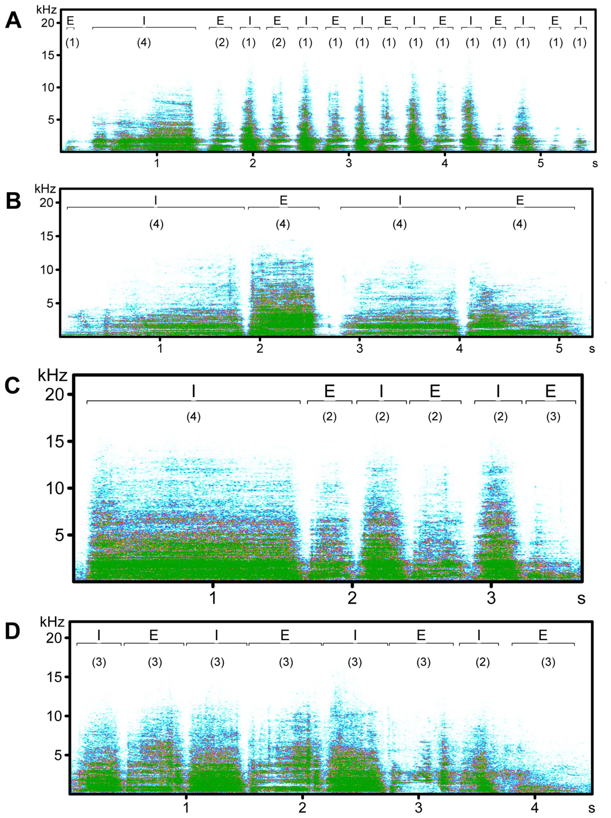
Contact pants alternate respiratory sound elements
A contact pant is a repeated rhinoceros vocalization associated with approach and maintaining social contact. It contains sound elements produced during inhalation and exhalation. Cinková and Policht displayed these elements as waveforms and spectrograms in northern and southern white rhinoceroses.
A waveform shows sound amplitude across time. A spectrogram displays the distribution of sound energy across frequency and time, with frequency expressed in hertz and time in seconds. The repeated elements expose how breathing organizes the temporal structure of the call.
Northern white rhinoceros calls averaged approximately 14 elements over 6 seconds, compared with approximately 9 elements over 4 seconds in southern white rhinoceroses. Temporal structure therefore varies among call sources. This variation provides one component of the acoustic information available to another rhinoceros.
Cinková & Policht (2014), Fig. 1. Contact pants alternate respiratory sound elements.
Cinková & Policht (2014)
34
Notes:
• A contact pant is a repeated rhinoceros vocalization associated with approach and maintaining social contact. It contains sound elements produced during inhalation and exhalation. Cinková and Policht displayed these elements as waveforms and spectrograms in northern and southern white rhinoceroses.
• A waveform shows sound amplitude across time. A spectrogram displays the distribution of sound energy across frequency and time, with frequency expressed in hertz and time in seconds. The repeated elements expose how breathing organizes the temporal structure of the call.
• Northern white rhinoceros calls averaged approximately 14 elements over 6 seconds, compared with approximately 9 elements over 4 seconds in southern white rhinoceroses. Temporal structure therefore varies among call sources. This variation provides one component of the acoustic information available to another rhinoceros.
• Read the original figure together with the claim. Follow the time and frequency axes of the original recordings. Acoustic separability identifies information in the signal; listener behavior is tested by the subsequent playback experiments.
References:
Cinková I; Policht R. (2014). Contact Calls of the Northern and Southern White Rhinoceros Allow for Individual and Species Identification. PLoS ONE 9:e98475. https://doi.org/10.1371/journal.pone.0098475
Figure: Cinková & Policht (2014), Fig. 1. Contact pants alternate respiratory sound elements.
Figure source: https://doi.org/10.1371/journal.pone.0098475

Slide 35
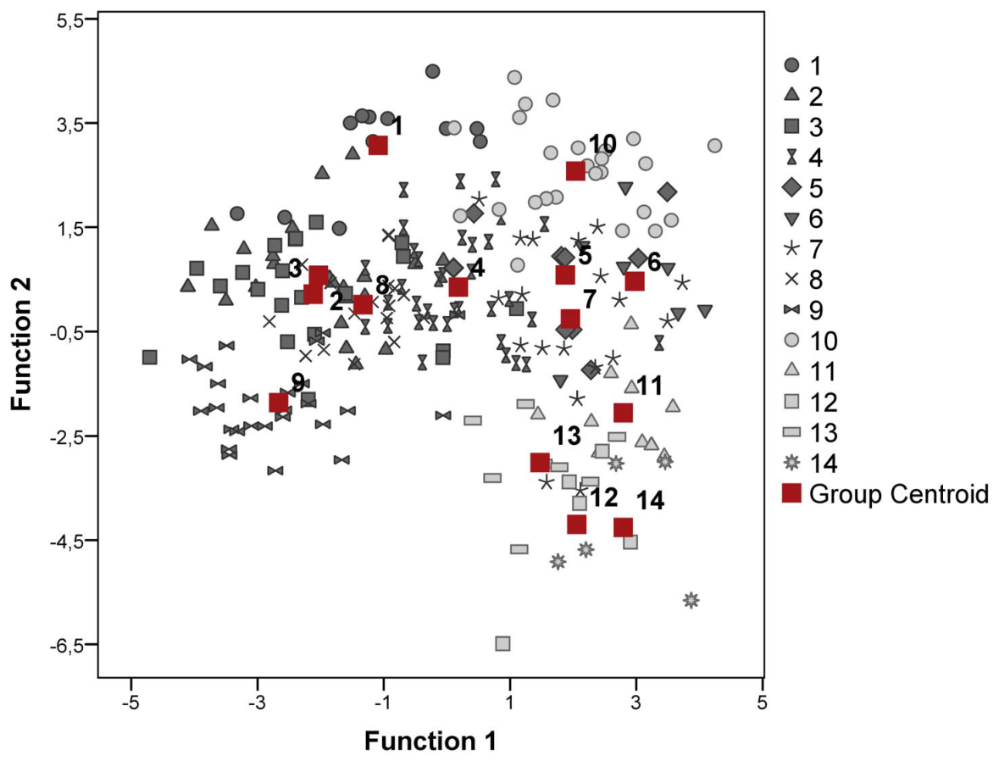
Individual callers differ in contact-call structure
Repeated contact pants from the same southern white rhinoceros shared acoustic features. Cinková and Policht measured temporal and spectral characteristics and compared calls across known individuals. Spectral characteristics describe how a sound's energy is distributed among frequencies.
The published comparison shows individuals occupying different positions in acoustic feature space. A feature space represents measurements as coordinates, making similarities and differences among calls visible. Such separation establishes that individual information is present in the recorded signals.
Information in a signal and recognition by a listener are different questions. The acoustic analysis identifies potential cues, while playback experiments test whether receivers respond differently to signal categories. Together these approaches connect respiratory call production to the social use of sound.
Cinková & Policht (2014), Fig. 3. Individual callers differ in contact-call structure.
Cinková & Policht (2014)
35
Notes:
• Repeated contact pants from the same southern white rhinoceros shared acoustic features. Cinková and Policht measured temporal and spectral characteristics and compared calls across known individuals. Spectral characteristics describe how a sound's energy is distributed among frequencies.
• The published comparison shows individuals occupying different positions in acoustic feature space. A feature space represents measurements as coordinates, making similarities and differences among calls visible. Such separation establishes that individual information is present in the recorded signals.
• Information in a signal and recognition by a listener are different questions. The acoustic analysis identifies potential cues, while playback experiments test whether receivers respond differently to signal categories. Together these approaches connect respiratory call production to the social use of sound.
• Read the original figure together with the claim. Follow the time and frequency axes of the original recordings. Acoustic separability identifies information in the signal; listener behavior is tested by the subsequent playback experiments.
References:
Cinková I; Policht R. (2014). Contact Calls of the Northern and Southern White Rhinoceros Allow for Individual and Species Identification. PLoS ONE 9:e98475. https://doi.org/10.1371/journal.pone.0098475
Figure: Cinková & Policht (2014), Fig. 3. Individual callers differ in contact-call structure.
Figure source: https://doi.org/10.1371/journal.pone.0098475

Slide 36
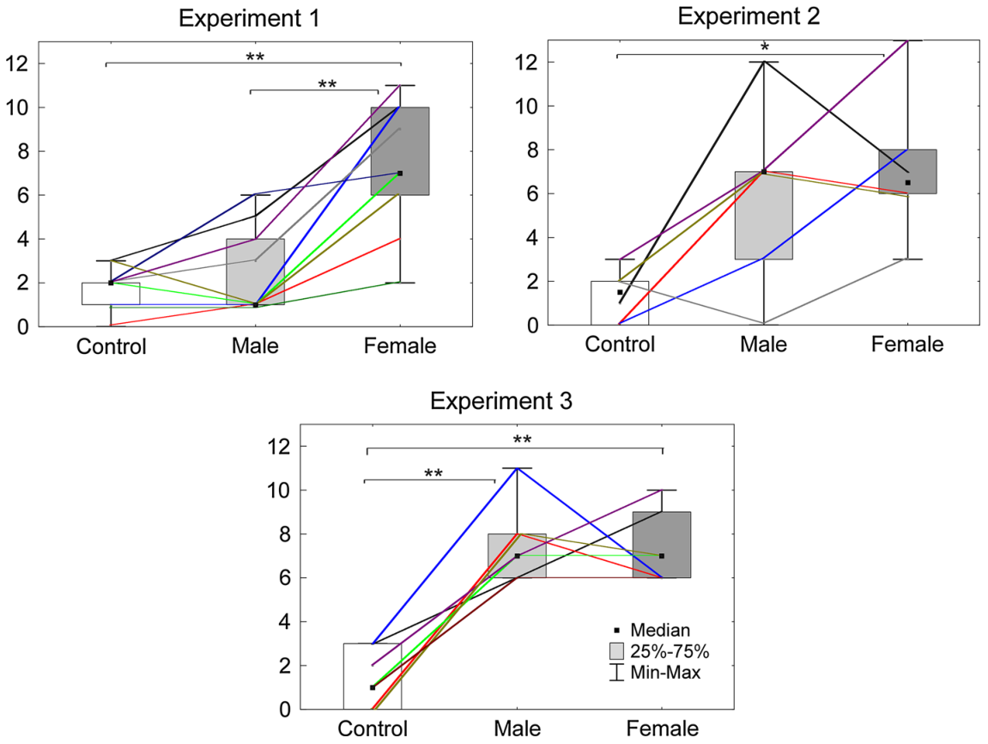
Male rhinoceroses distinguish sex through contact calls
Cinková and Policht played contact pants to free-ranging male southern white rhinoceroses. Loudspeaker presentations separated sound from the donor's immediate visual presence. Playback levels ranged from 85–97 dB at 1 m, adjusted for speaker distances of approximately 15–40 m.
When males were alone, female southern white rhinoceros calls elicited stronger responses than male calls. The experiment scored orienting, vigilance, and movement rather than relying on an observer's general impression. Neutral bird sounds provided a comparison for responses to non-rhinoceros acoustic events.
The contrast demonstrates that information carried by contact pants can alter receiver behavior. Strong responses often included approach soon after playback began. Acoustic sex discrimination therefore connects signal structure to a behavioral decision made without simultaneously seeing the calling animal.
Cinková & Policht (2016), Fig. 3. Male rhinoceroses distinguish sex through contact calls.
Cinková & Policht (2016)
36
Notes:
• Cinková and Policht played contact pants to free-ranging male southern white rhinoceroses. Loudspeaker presentations separated sound from the donor's immediate visual presence. Playback levels ranged from 85–97 dB at 1 m, adjusted for speaker distances of approximately 15–40 m.
• When males were alone, female southern white rhinoceros calls elicited stronger responses than male calls. The experiment scored orienting, vigilance, and movement rather than relying on an observer's general impression. Neutral bird sounds provided a comparison for responses to non-rhinoceros acoustic events.
• The contrast demonstrates that information carried by contact pants can alter receiver behavior. Strong responses often included approach soon after playback began. Acoustic sex discrimination therefore connects signal structure to a behavioral decision made without simultaneously seeing the calling animal.
• Read the original figure together with the claim. Separate response intensity from the timing and form of movement. The playback delivers an acoustic signal independently of the donor, while the animal’s visible companions supply additional social context.
References:
Cinková I; Policht R. (2016). Sex and species recognition by wild male southern white rhinoceros using contact pant calls. Animal Cognition 19:375-386. https://doi.org/10.1007/s10071-015-0940-7
Figure: Cinková & Policht (2016), Fig. 3. Male rhinoceroses distinguish sex through contact calls.
Figure source: https://doi.org/10.1007/s10071-015-0940-7

Slide 37
Visible companions change responses to acoustic cues
The playback study also examined males when a female was visibly nearby. Under this social condition, the difference between responses to female and male southern white rhinoceros pants was absent. The same acoustic categories therefore produced different contrasts depending on the receiver's current social setting.
A visible female supplies information through a sensory channel other than sound. The experiment illustrates sensory integration, the combination of information from different sensory sources to guide behavior. It also changes the immediate social opportunities available to the male.
The outcome connects acoustic discrimination to ongoing interaction rather than a fixed response to a call in isolation. A receiver evaluates a sound while already possessing information about nearby animals. The direction and intensity of movement consequently depend on both the presented signal and the animal's current surroundings.
Cinková & Policht (2016), Fig. 3. Visible companions change responses to acoustic cues.
Cinková & Policht (2016)
37
Notes:
• The playback study also examined males when a female was visibly nearby. Under this social condition, the difference between responses to female and male southern white rhinoceros pants was absent. The same acoustic categories therefore produced different contrasts depending on the receiver's current social setting.
• A visible female supplies information through a sensory channel other than sound. The experiment illustrates sensory integration, the combination of information from different sensory sources to guide behavior. It also changes the immediate social opportunities available to the male.
• The outcome connects acoustic discrimination to ongoing interaction rather than a fixed response to a call in isolation. A receiver evaluates a sound while already possessing information about nearby animals. The direction and intensity of movement consequently depend on both the presented signal and the animal's current surroundings.
• Read the original figure together with the claim. Separate response intensity from the timing and form of movement. The playback delivers an acoustic signal independently of the donor, while the animal’s visible companions supply additional social context.
References:
Cinková I; Policht R. (2016). Sex and species recognition by wild male southern white rhinoceros using contact pant calls. Animal Cognition 19:375-386. https://doi.org/10.1007/s10071-015-0940-7
Figure: Cinková & Policht (2016), Fig. 3. Visible companions change responses to acoustic cues.
Figure source: https://doi.org/10.1007/s10071-015-0940-7

Slide 38
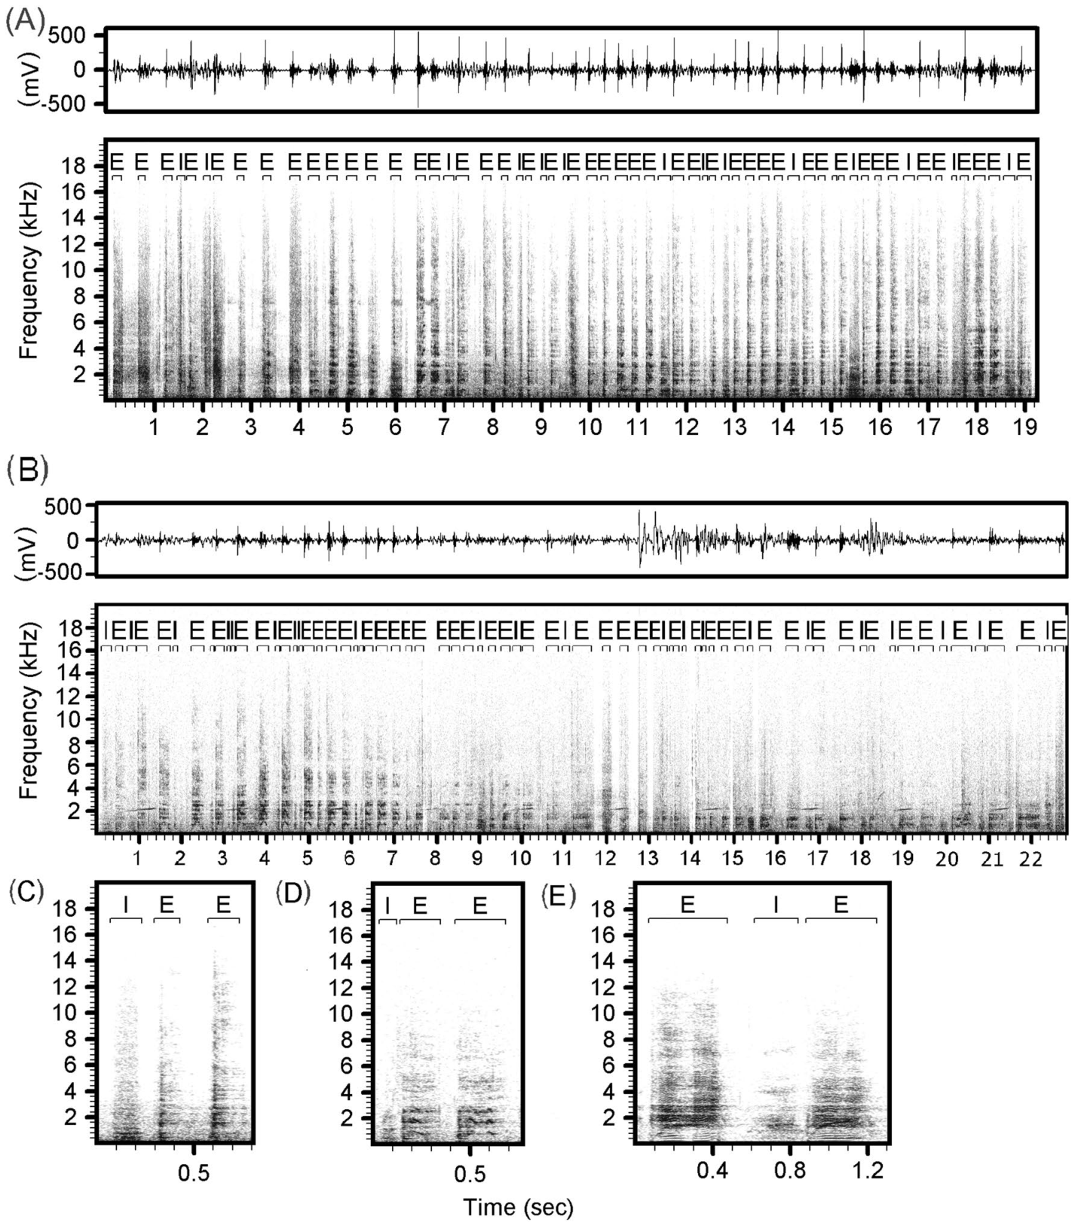
Courtship hics form a separate repeated call pattern
Male white rhinoceroses produce hic calls during courtship approaches. These are repeated sound elements distinct from contact pants. Cinková and Shrader analyzed calls from known northern and southern white rhinoceroses and compared their temporal and frequency structure.
The published waveforms and spectrograms show how repeated inhalation and exhalation elements form the call sequence. One measured minimum-frequency characteristic of inhalation elements was approximately 0.30 kHz in northern callers and 2.03 kHz in southern callers. A kilohertz equals 1,000 hertz.
Individual callers also differed in acoustic features. The courtship signal therefore contains both individual variation and differences associated with the two white rhinoceros forms. Its social role is grounded in the observed approach context, while controlled playback tests investigate the receiver's response to that sound pattern.
Cinková & Shrader (2022), Fig. 1. Courtship hics form a separate repeated call pattern.
Cinková & Shrader (2022)
38
Notes:
• Male white rhinoceroses produce hic calls during courtship approaches. These are repeated sound elements distinct from contact pants. Cinková and Shrader analyzed calls from known northern and southern white rhinoceroses and compared their temporal and frequency structure.
• The published waveforms and spectrograms show how repeated inhalation and exhalation elements form the call sequence. One measured minimum-frequency characteristic of inhalation elements was approximately 0.30 kHz in northern callers and 2.03 kHz in southern callers. A kilohertz equals 1,000 hertz.
• Individual callers also differed in acoustic features. The courtship signal therefore contains both individual variation and differences associated with the two white rhinoceros forms. Its social role is grounded in the observed approach context, while controlled playback tests investigate the receiver's response to that sound pattern.
• Read the original figure together with the claim. Compare initial reaction, vigilance, and approach as different behavioral outcomes. The tested females were anoestrous mothers with calves, making the experiment a study of responses to courtship-associated sounds in that social state.
References:
Cinková I; Shrader AM. (2022). Individuality, species-specific features, and female discrimination of male southern white rhinoceros courtship calls. Animal Cognition 25:769-782. https://doi.org/10.1007/s10071-021-01591-4
Figure: Cinková & Shrader (2022), Fig. 1. Courtship hics form a separate repeated call pattern.
Figure source: https://doi.org/10.1007/s10071-021-01591-4

Slide 39
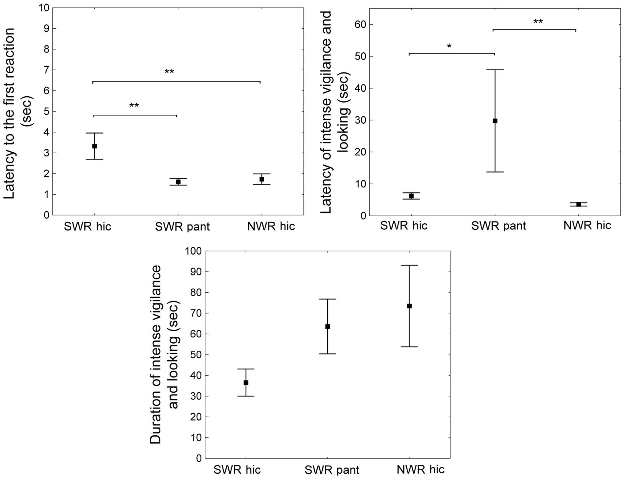
Female responses distinguish call timing and duration
Cinková and Shrader played northern hic calls, southern hic calls, and southern contact pants to wild southern white rhinoceros females with calves. The females were anoestrous, meaning outside oestrus. Presentations lasted approximately 13 seconds and used speaker distances of 15–35 m.
All three rhinoceros call categories elicited more response than neutral bird sounds. Overall response intensity was similar among the rhinoceros categories, but response timing differed. Females began their first reactions sooner to northern hics and contact pants than to southern hics.
Hic calls also elicited vigilance sooner than contact pants, while vigilance duration was similar. Timing and duration thus capture different aspects of auditory behavior. Because the subjects were anoestrous mothers, these responses characterize attention and monitoring rather than demonstrating selection of a mating partner.
Cinková & Shrader (2022), Fig. 4. Female responses distinguish call timing and duration.
Cinková & Shrader (2022)
39
Notes:
• Cinková and Shrader played northern hic calls, southern hic calls, and southern contact pants to wild southern white rhinoceros females with calves. The females were anoestrous, meaning outside oestrus. Presentations lasted approximately 13 seconds and used speaker distances of 15–35 m.
• All three rhinoceros call categories elicited more response than neutral bird sounds. Overall response intensity was similar among the rhinoceros categories, but response timing differed. Females began their first reactions sooner to northern hics and contact pants than to southern hics.
• Hic calls also elicited vigilance sooner than contact pants, while vigilance duration was similar. Timing and duration thus capture different aspects of auditory behavior. Because the subjects were anoestrous mothers, these responses characterize attention and monitoring rather than demonstrating selection of a mating partner.
• Read the original figure together with the claim. Compare initial reaction, vigilance, and approach as different behavioral outcomes. The tested females were anoestrous mothers with calves, making the experiment a study of responses to courtship-associated sounds in that social state.
References:
Cinková I; Shrader AM. (2022). Individuality, species-specific features, and female discrimination of male southern white rhinoceros courtship calls. Animal Cognition 25:769-782. https://doi.org/10.1007/s10071-021-01591-4
Figure: Cinková & Shrader (2022), Fig. 4. Female responses distinguish call timing and duration.
Figure source: https://doi.org/10.1007/s10071-021-01591-4

Slide 40
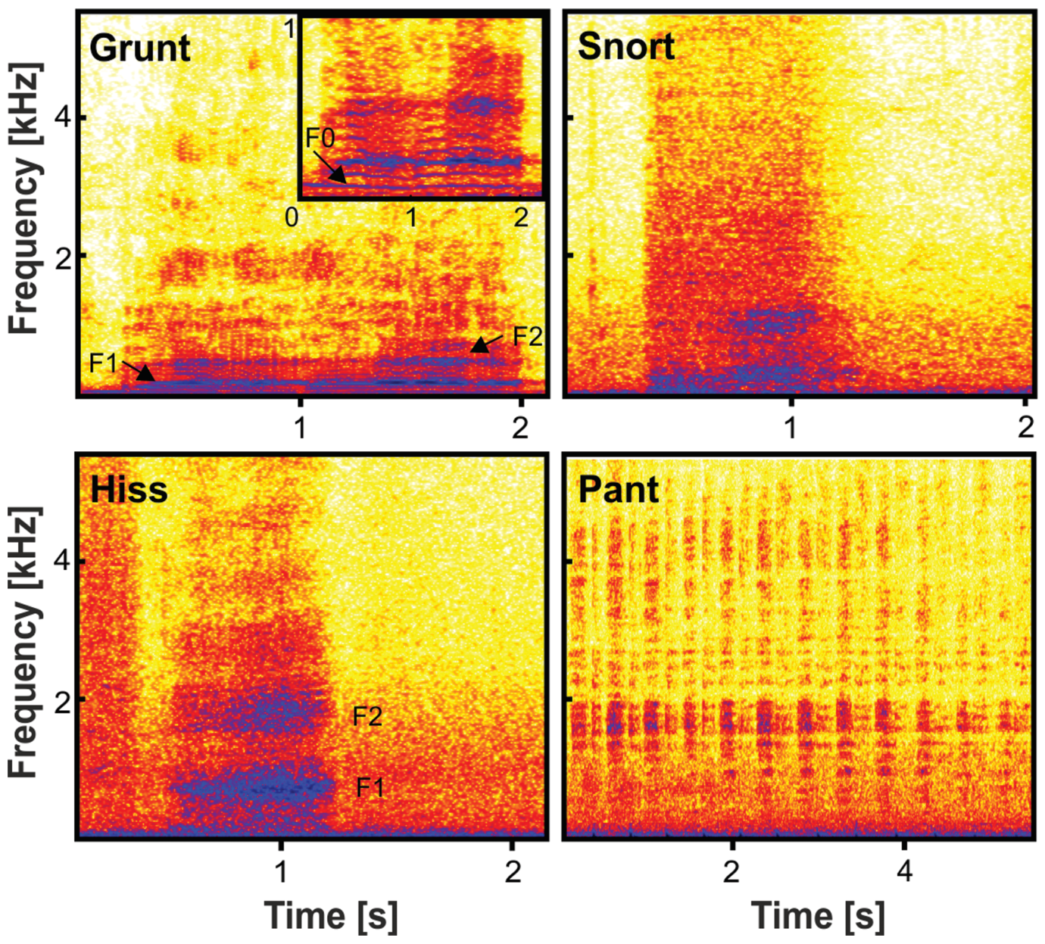
Grunts combine a vocal source with resonant filtering
Linn and colleagues compared individual distinctiveness in grunts, hisses, and snorts. A grunt contains a mixed harmonic structure, meaning that energy occurs near multiples of a fundamental frequency. The displayed grunt example has a fundamental near 60 Hz.
The fundamental frequency reflects the repetition rate of the vibrating sound source. Formants are frequency regions strengthened by resonance in the vocal tract. The published spectrogram identifies these features, distinguishing the source's repetition from the tract's selective amplification.
Among the studied adult call types, grunts carried stronger individual distinctiveness than hisses or snorts. Source properties and resonant filtering can consequently contribute different acoustic cues within the same call. The comparison connects the physical production of a sound to the information available about its caller.
Linn et al. (2021), Fig. 1. Grunts combine a vocal source with resonant filtering.
Linn et al. (2021)
40
Notes:
• Linn and colleagues compared individual distinctiveness in grunts, hisses, and snorts. A grunt contains a mixed harmonic structure, meaning that energy occurs near multiples of a fundamental frequency. The displayed grunt example has a fundamental near 60 Hz.
• The fundamental frequency reflects the repetition rate of the vibrating sound source. Formants are frequency regions strengthened by resonance in the vocal tract. The published spectrogram identifies these features, distinguishing the source's repetition from the tract's selective amplification.
• Among the studied adult call types, grunts carried stronger individual distinctiveness than hisses or snorts. Source properties and resonant filtering can consequently contribute different acoustic cues within the same call. The comparison connects the physical production of a sound to the information available about its caller.
• Read the original figure together with the claim. Compare the acoustic structure of the call types rather than treating every sound as a single category. The original spectrogram distinguishes harmonic energy from noisy components and places the measurements on a frequency and time scale.
References:
Linn SN; Schmidt S; Scheumann M. (2021). Individual distinctiveness across call types of the southern white rhinoceros (Ceratotherium simum simum). Journal of Mammalogy 102:440-456. https://doi.org/10.1093/jmammal/gyab007
Figure: Linn et al. (2021), Fig. 1. Grunts combine a vocal source with resonant filtering.
Figure source: https://doi.org/10.1093/jmammal/gyab007

Slide 41
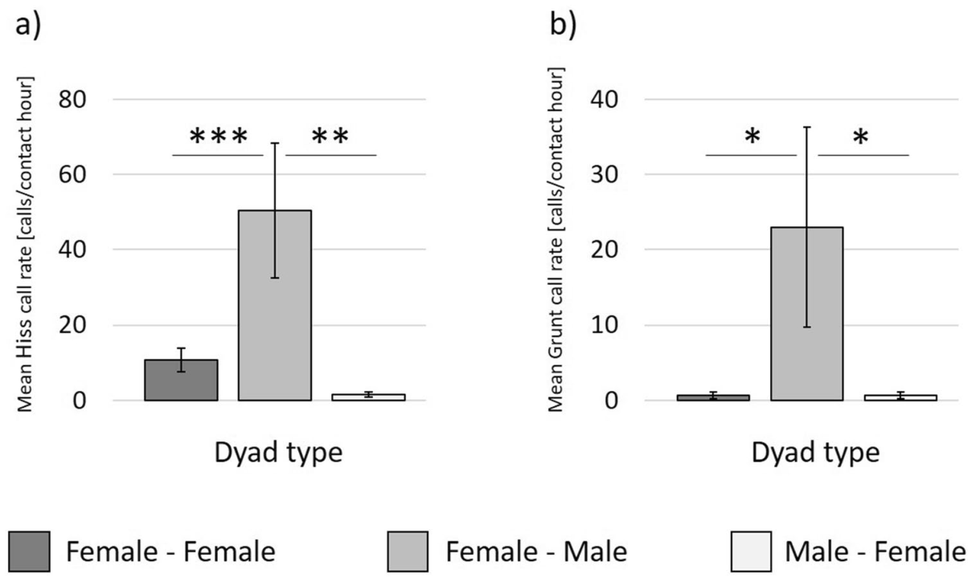
Call types allocate social information differently
Jenikejew and colleagues compared how different calls were directed among nearby rhinoceroses. Females produced approximately 6.45 hisses per hour, compared with 0.80 per hour in males. Male contact pants occurred at approximately 1.24 per hour, compared with 0.18 per hour in females.
A hiss is a noisy vocal signal frequently associated with repulsion or agonistic interaction. Hiss and grunt rates were particularly high in female-to-male dyads. A dyad is a pair of individuals considered together when measuring interaction.
The same animals can therefore participate in differently structured vocal relationships depending on the signal. Call type links production to social function: repelling an approach, managing proximity, or maintaining contact. Counting all vocalizations together would conceal these distinct patterns of interaction.
Jenikejew et al. (2020), Fig. 4. Call types allocate social information differently.
Jenikejew et al. (2020)
41
Notes:
• Jenikejew and colleagues compared how different calls were directed among nearby rhinoceroses. Females produced approximately 6.45 hisses per hour, compared with 0.80 per hour in males. Male contact pants occurred at approximately 1.24 per hour, compared with 0.18 per hour in females.
• A hiss is a noisy vocal signal frequently associated with repulsion or agonistic interaction. Hiss and grunt rates were particularly high in female-to-male dyads. A dyad is a pair of individuals considered together when measuring interaction.
• The same animals can therefore participate in differently structured vocal relationships depending on the signal. Call type links production to social function: repelling an approach, managing proximity, or maintaining contact. Counting all vocalizations together would conceal these distinct patterns of interaction.
• Read the original figure together with the claim. Read the directed links relative to the animals and their time in proximity. A nearby animal is a potential recipient, not automatically a proven intended recipient. Call-specific networks reveal patterns that an undifferentiated count of all calls would conceal.
References:
Jenikejew J; Chaignon B; Linn S; Scheumann M. (2020). Proximity-based vocal networks reveal social relationships in the Southern white rhinoceros. Scientific Reports 10:15104. https://doi.org/10.1038/s41598-020-72052-0
Figure: Jenikejew et al. (2020), Fig. 4. Call types allocate social information differently.
Figure source: https://doi.org/10.1038/s41598-020-72052-0

Slide 42
Stronger female associations reduce agonistic calling
The vocal-network study related calling to the time rhinoceroses spent near particular companions. An association measures repeated proximity between individuals. Stronger female associations were linked to lower rates of agonistic calls between those females.
Directed networks represent each individual as a node and each calling relationship as a link. The published networks were constructed by the researchers from observed behavior; their colors distinguish animals and interaction patterns. Rates account for exposure time so frequent proximity is not automatically interpreted as stronger signaling.
The contrast connects relationship history to how animals manage immediate closeness. Familiar companions can remain nearby with less repulsive signaling than other pairings. The social meaning of a call is therefore clarified by considering both its acoustic form and the relationship between producer and potential receiver.
Jenikejew et al. (2020), Fig. 2. Stronger female associations reduce agonistic calling.
Jenikejew et al. (2020)
42
Notes:
• The vocal-network study related calling to the time rhinoceroses spent near particular companions. An association measures repeated proximity between individuals. Stronger female associations were linked to lower rates of agonistic calls between those females.
• Directed networks represent each individual as a node and each calling relationship as a link. The published networks were constructed by the researchers from observed behavior; their colors distinguish animals and interaction patterns. Rates account for exposure time so frequent proximity is not automatically interpreted as stronger signaling.
• The contrast connects relationship history to how animals manage immediate closeness. Familiar companions can remain nearby with less repulsive signaling than other pairings. The social meaning of a call is therefore clarified by considering both its acoustic form and the relationship between producer and potential receiver.
• Read the original figure together with the claim. Read the directed links relative to the animals and their time in proximity. A nearby animal is a potential recipient, not automatically a proven intended recipient. Call-specific networks reveal patterns that an undifferentiated count of all calls would conceal.
References:
Jenikejew J; Chaignon B; Linn S; Scheumann M. (2020). Proximity-based vocal networks reveal social relationships in the Southern white rhinoceros. Scientific Reports 10:15104. https://doi.org/10.1038/s41598-020-72052-0
Figure: Jenikejew et al. (2020), Fig. 2. Stronger female associations reduce agonistic calling.
Figure source: https://doi.org/10.1038/s41598-020-72052-0

Slide 43
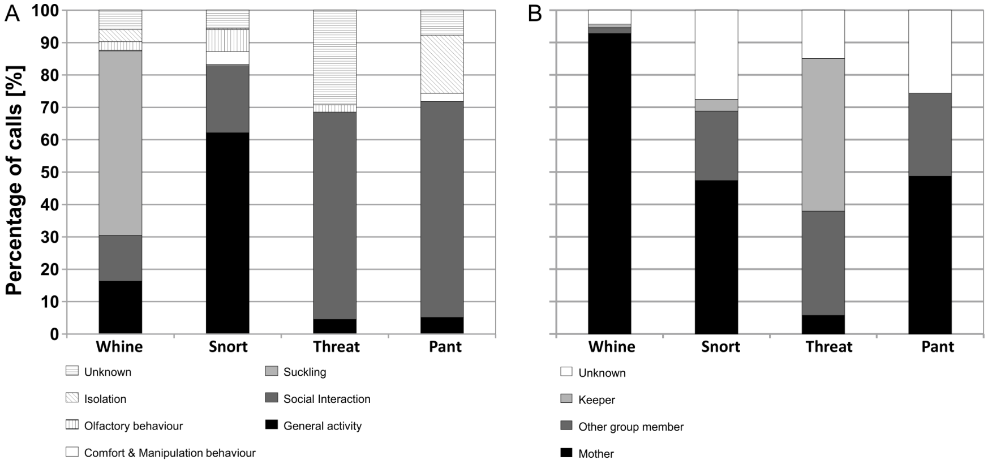
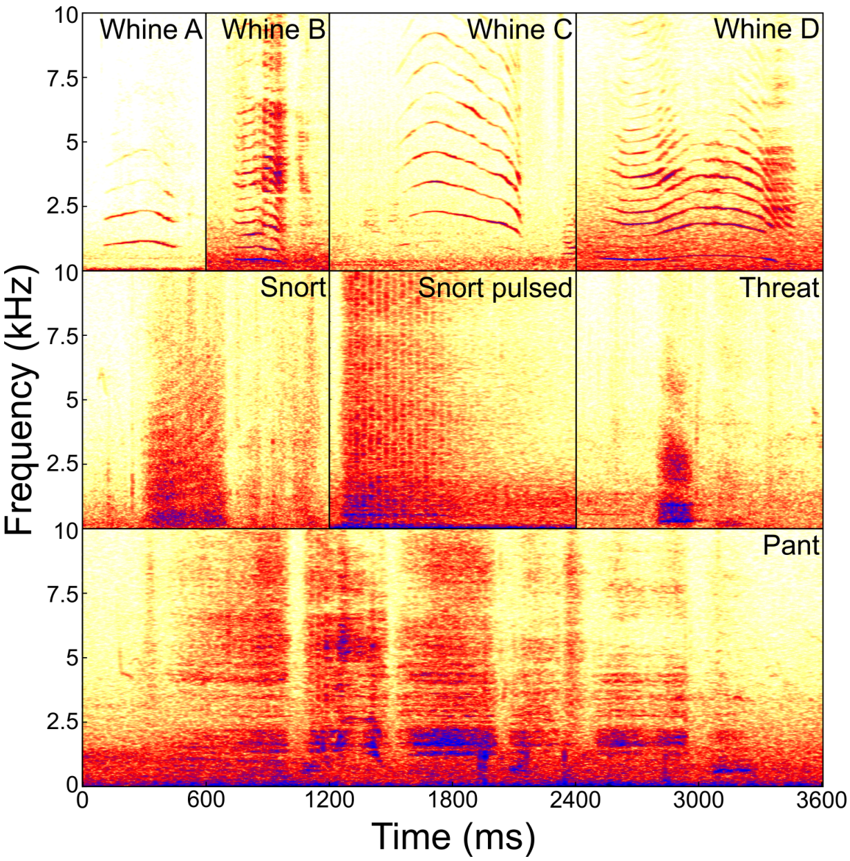
Young rhinoceroses whine near mothers and feeding
Linn and colleagues described four call types in infant and juvenile southern white rhinoceroses: whines, snorts, threats, and pants. A whine is a tonal call, with energy concentrated along an identifiable frequency trajectory. The recorded whines lasted approximately 0.11–3.51 seconds.
Whines occurred especially near mothers and around suckling. The published context graphs separate the activity accompanying a call from the nearby animal that could receive it. This connects vocal production to both an immediate bodily activity and a social partner.
Threat calls occurred during close interactions and could be followed by the recipient moving away. Pants accompanied approach and following, often at greater separation. Even early in development, different vocal patterns are therefore linked to distinct social actions rather than functioning as interchangeable attention signals.
Linn et al. (2018), Fig. 3. Young rhinoceroses whine near mothers and feeding.
Linn et al. (2018), Fig. 1. Spectrograms distinguish the juvenile call repertoire.
Linn et al. (2018)
43
Notes:
• Linn and colleagues described four call types in infant and juvenile southern white rhinoceroses: whines, snorts, threats, and pants. A whine is a tonal call, with energy concentrated along an identifiable frequency trajectory. The recorded whines lasted approximately 0.11–3.51 seconds.
• Whines occurred especially near mothers and around suckling. The published context graphs separate the activity accompanying a call from the nearby animal that could receive it. This connects vocal production to both an immediate bodily activity and a social partner.
• Threat calls occurred during close interactions and could be followed by the recipient moving away. Pants accompanied approach and following, often at greater separation. Even early in development, different vocal patterns are therefore linked to distinct social actions rather than functioning as interchangeable attention signals.
• Read the original figure together with the claim. Relate the observed call to the activity and partner recorded at the same time. Development changes the distribution of calls among social contexts, and a hand-reared calf illustrates how a human feeding partner can become the recipient of a familiar vocal pattern.
References:
Linn SN; Boeer M; Scheumann M. (2018). First insights into the vocal repertoire of infant and juvenile Southern white rhinoceros. PLOS ONE 13:e0192166. https://doi.org/10.1371/journal.pone.0192166
Figure: Linn et al. (2018), Fig. 3. Young rhinoceroses whine near mothers and feeding.
Figure source: https://doi.org/10.1371/journal.pone.0192166
Figure: Linn et al. (2018), Fig. 1. Spectrograms distinguish the juvenile call repertoire.
Figure source: https://doi.org/10.1371/journal.pone.0192166

Slide 44
Vocal use changes as young rhinoceroses develop
Whining declined with age in the infant and juvenile vocal study. Animals younger than 18 months produced approximately 20.77 whines per hour, compared with 2.99 per hour in older juveniles. Other measured call types did not show the same age-related decline.
The developmental change matches the strong association between whining and mother-linked feeding contexts. A hand-reared calf produced all four recorded call types but used whines especially frequently, approximately 169.29 per hour. Human keepers became relevant recipients in its feeding interactions.
The call repertoire and its rate of use are therefore separate developmental features. Producing a recognizable call type does not require using it with the same frequency or toward the same partner in every rearing context. Social experience and feeding arrangements change where the young animal deploys its signals.
Linn et al. (2018), Fig. 3. Vocal use changes as young rhinoceroses develop.
Linn et al. (2018), Fig. 1. Spectrograms distinguish the juvenile call repertoire.
Linn et al. (2018)
44
Notes:
• Whining declined with age in the infant and juvenile vocal study. Animals younger than 18 months produced approximately 20.77 whines per hour, compared with 2.99 per hour in older juveniles. Other measured call types did not show the same age-related decline.
• The developmental change matches the strong association between whining and mother-linked feeding contexts. A hand-reared calf produced all four recorded call types but used whines especially frequently, approximately 169.29 per hour. Human keepers became relevant recipients in its feeding interactions.
• The call repertoire and its rate of use are therefore separate developmental features. Producing a recognizable call type does not require using it with the same frequency or toward the same partner in every rearing context. Social experience and feeding arrangements change where the young animal deploys its signals.
• Read the original figure together with the claim. Relate the observed call to the activity and partner recorded at the same time. Development changes the distribution of calls among social contexts, and a hand-reared calf illustrates how a human feeding partner can become the recipient of a familiar vocal pattern.
References:
Linn SN; Boeer M; Scheumann M. (2018). First insights into the vocal repertoire of infant and juvenile Southern white rhinoceros. PLOS ONE 13:e0192166. https://doi.org/10.1371/journal.pone.0192166
Figure: Linn et al. (2018), Fig. 3. Vocal use changes as young rhinoceroses develop.
Figure source: https://doi.org/10.1371/journal.pone.0192166
Figure: Linn et al. (2018), Fig. 1. Spectrograms distinguish the juvenile call repertoire.
Figure source: https://doi.org/10.1371/journal.pone.0192166

Slide 45
Recognition emerges through signal, context, and action
Rhinoceros social communication can be examined at three linked levels: the physical signal, the receiver's available information, and its resulting behavior. Dung chemistry persists at shared sites, while calls provide rapidly changing information about an animal that may be out of view.
Anatomical studies locate olfactory pathways and the peripheral auditory apparatus. Chemical analyses and acoustic measurements identify variation in signals. Controlled field presentations then connect that variation to sniffing, vigilance, orienting, approach, and other observable actions.
The strongest explanation combines these levels while preserving what each experiment measured. Familiarity changes chemical investigation, visible companions alter auditory responses, and relationships change directed calling. Social recognition is expressed through this context-dependent organization of behavior rather than through one universal signal or one isolated brain structure.
Jenikejew et al. (2020), Fig. 2. Recognition emerges through signal, context, and action.
Jenikejew et al. (2020)
45
Notes:
• Rhinoceros social communication can be examined at three linked levels: the physical signal, the receiver's available information, and its resulting behavior. Dung chemistry persists at shared sites, while calls provide rapidly changing information about an animal that may be out of view.
• Anatomical studies locate olfactory pathways and the peripheral auditory apparatus. Chemical analyses and acoustic measurements identify variation in signals. Controlled field presentations then connect that variation to sniffing, vigilance, orienting, approach, and other observable actions.
• The strongest explanation combines these levels while preserving what each experiment measured. Familiarity changes chemical investigation, visible companions alter auditory responses, and relationships change directed calling. Social recognition is expressed through this context-dependent organization of behavior rather than through one universal signal or one isolated brain structure.
• Read the original figure together with the claim. Read the directed links relative to the animals and their time in proximity. A nearby animal is a potential recipient, not automatically a proven intended recipient. Call-specific networks reveal patterns that an undifferentiated count of all calls would conceal.
References:
Jenikejew J; Chaignon B; Linn S; Scheumann M. (2020). Proximity-based vocal networks reveal social relationships in the Southern white rhinoceros. Scientific Reports 10:15104. https://doi.org/10.1038/s41598-020-72052-0
Figure: Jenikejew et al. (2020), Fig. 2. Recognition emerges through signal, context, and action.
Figure source: https://doi.org/10.1038/s41598-020-72052-0

Slide 46
Key takeaways
Anatomical pathways Olfactory structures occupy ventral forebrain territories; the auditory apparatus links the eardrum and ossicles to the cochlea and cranial-nerve route.
Persistent chemical information Middens carry multicomponent odors related to sex, age, territorial status, and reproductive condition.
Selective behavioral responses Rival-like and female-like odors alter visitation, vigilance, and sniffing in different combinations.
Acoustic identity and recognition Call structure contains caller information, while playback tests demonstrate changes in the receiver’s behavior.
Context-dependent communication Visible companions and relationship history alter responses to signals and patterns of directed calling.
Developmental deployment Young rhinoceroses use distinct call types in feeding and social contexts; whine rates decline with age and differ with rearing conditions.
Bhagwandin et al. (2017); Marneweck et al. (2017); Cinková & Policht (2016); Jenikejew et al. (2020)
46
Notes:
Bhagwandin A; Haagensen M; Manger PR. (2017). The Brain of the Black (Diceros bicornis) and White (Ceratotherium simum) African Rhinoceroses: Morphology and Volumetrics from Magnetic Resonance Imaging. Frontiers in Neuroanatomy 11:74. https://doi.org/10.3389/fnana.2017.00074
Robert MP; Carstens A; de Beer FC; Hoffman JW; Steenkamp G. (2021). Micro‐anatomy of the ear of the southern white rhinoceros (Ceratotherium simum simum). Anatomia, Histologia, Embryologia 50:316-323. https://doi.org/10.1111/ahe.12632
Marneweck C; Jürgens A; Shrader AM. (2017). Dung odours signal sex, age, territorial and oestrous state in white rhinos. Proceedings of the Royal Society B: Biological Sciences 284:20162376. https://doi.org/10.1098/rspb.2016.2376
Cinková I; Policht R. (2015). Discrimination of familiarity and sex from chemical cues in the dung by wild southern white rhinoceros. Animal Cognition 18:385-392. https://doi.org/10.1007/s10071-014-0810-8
Cinková I; Policht R. (2014). Contact Calls of the Northern and Southern White Rhinoceros Allow for Individual and Species Identification. PLoS ONE 9:e98475. https://doi.org/10.1371/journal.pone.0098475
Linn SN; Schmidt S; Scheumann M. (2021). Individual distinctiveness across call types of the southern white rhinoceros (Ceratotherium simum simum). Journal of Mammalogy 102:440-456. https://doi.org/10.1093/jmammal/gyab007
Cinková I; Policht R. (2016). Sex and species recognition by wild male southern white rhinoceros using contact pant calls. Animal Cognition 19:375-386. https://doi.org/10.1007/s10071-015-0940-7
Cinková I; Shrader AM. (2022). Individuality, species-specific features, and female discrimination of male southern white rhinoceros courtship calls. Animal Cognition 25:769-782. https://doi.org/10.1007/s10071-021-01591-4
Jenikejew J; Chaignon B; Linn S; Scheumann M. (2020). Proximity-based vocal networks reveal social relationships in the Southern white rhinoceros. Scientific Reports 10:15104. https://doi.org/10.1038/s41598-020-72052-0
Linn SN; Boeer M; Scheumann M. (2018). First insights into the vocal repertoire of infant and juvenile Southern white rhinoceros. PLOS ONE 13:e0192166. https://doi.org/10.1371/journal.pone.0192166

