Slide 1
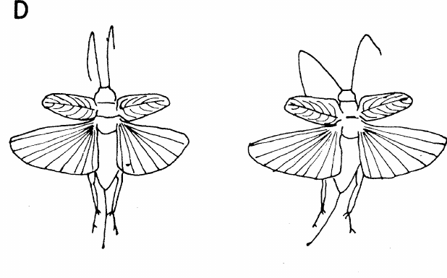
NEUR 411 · NEUROETHOLOGY · FALL 2026
Lecture 14
Insect hearing I:
cricket phonotaxis and song recognition (Hoy)
Friday, September 25, 2026
Jordan Lopez, Ph.D.
Professor of Neurobiology & Biomedical Engineering
Pollack & Hoy (1979), Fig. 2(D). Tethered field cricket during flight.
Notes:
Insect hearing I: cricket phonotaxis and song recognition (Hoy)
Lecture 14. NEUR 411 · NEUROETHOLOGY · FALL 2026. Friday, September 25, 2026.
Figure: Pollack & Hoy (1979), Fig. 2(D). Tethered field cricket during flight.
Figure source: https://doi.org/10.1126/science.204.4391.429
References:
Pollack GS, Hoy RR (1979). Temporal pattern as a cue for species-specific calling song recognition in crickets. Science 204(4391):429–432. https://doi.org/10.1126/science.204.4391.429

Slide 2
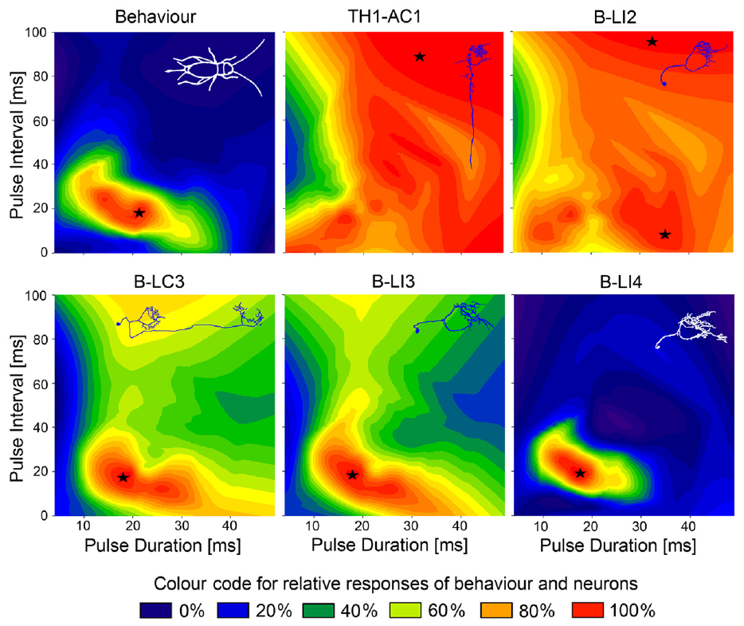
Females approach species-specific calling songs
Phonotaxis is movement oriented toward or away from a sound source. Female Gryllus bimaculatus approach the male calling song, a repeated sequence of brief sound pulses. A chirp groups several pulses before a longer silent interval.
Kostarakos and Hedwig tested tethered females walking on a trackball with synthetic songs whose carrier frequency was 4.8 kHz. The carrier frequency specifies the rapid sound oscillation within each pulse; pulse timing describes the slower pattern of its amplitude.
Females responded most strongly to pulse periods near 34–42 ms. Controlled synthetic patterns separate frequency from timing, supporting temporal selectivity rather than indiscriminate attraction to any audible sound. Trackball steering measures orientation under tethering rather than successful arrival at a male.
Kostarakos & Hedwig (2012), Fig. 6. Published behavior and neuronal response heat maps.
Kostarakos & Hedwig (2012)
02
Notes:
• **Phonotaxis** is movement oriented toward or away from a sound source. Female _Gryllus bimaculatus_ approach the male calling song, a repeated sequence of brief sound pulses. A **chirp** groups several pulses before a longer silent interval.
• Kostarakos and Hedwig tested tethered females walking on a trackball with synthetic songs whose carrier frequency was 4.8 kHz. The **carrier frequency** specifies the rapid sound oscillation within each pulse; pulse timing describes the slower pattern of its amplitude.
• Females responded most strongly to pulse periods near 34–42 ms. Controlled synthetic patterns separate frequency from timing, supporting temporal selectivity rather than indiscriminate attraction to any audible sound. Trackball steering measures orientation under tethering rather than successful arrival at a male.
• The heat maps preserve the authors’ distinction between pulse duration and the silent interval. A preferred region in behavioral space can be compared with neuronal response regions without assuming that any responding neuron recognizes the song.
References:
Kostarakos K, Hedwig B (2012). Calling song recognition in female crickets: temporal tuning of identified brain neurons matches behavior. Journal of Neuroscience 32(28):9601–9612. https://doi.org/10.1523/JNEUROSCI.1170-12.2012
Figure: Kostarakos & Hedwig (2012), Fig. 6. Published behavior and neuronal response heat maps.
Figure source: https://doi.org/10.1523/JNEUROSCI.1170-12.2012

Slide 3
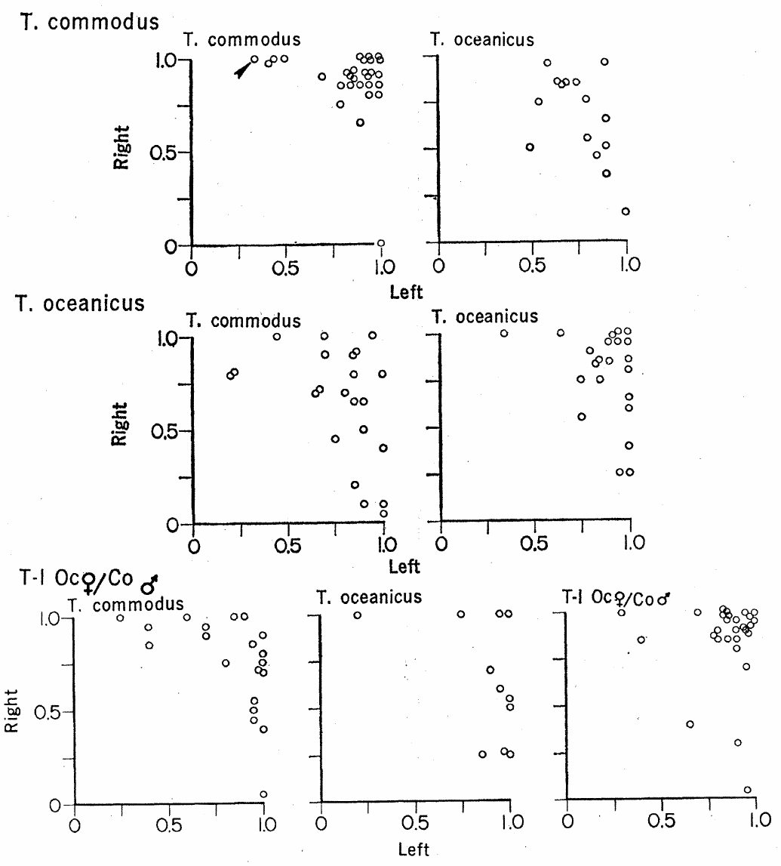
Hoy quantified directional song preference
Hoy and Paul studied Teleogryllus oceanicus and T. commodus, species with different calling-song rhythms. A phonomotor response was the female’s tendency to turn toward a song while walking on a small rotating Y-maze rather than traveling through an arena.
Speakers were positioned 94 cm from the maze and 40° to either side. Calls were presented at 69 dB, and the active speaker changed sides. Playback and recording temperatures were matched within 2°C because cricket song timing depends on temperature.
Females preferentially turned toward their own species’ song, although heterospecific songs could also attract them. Reversing speaker position distinguishes song preference from a persistent turning bias. These behavioral choices establish discrimination but do not locate its neurons or identify the genes responsible.
Hoy & Paul (1973), Fig. 1. Species and hybrid song preferences.
Hoy & Paul (1973)
03
Notes:
• Hoy and Paul studied _Teleogryllus oceanicus_ and _T. commodus_, species with different calling-song rhythms. A **phonomotor response** was the female’s tendency to turn toward a song while walking on a small rotating Y-maze rather than traveling through an arena.
• Speakers were positioned 94 cm from the maze and 40° to either side. Calls were presented at 69 dB, and the active speaker changed sides. Playback and recording temperatures were matched within 2°C because cricket song timing depends on temperature.
• Females preferentially turned toward their own species’ song, although heterospecific songs could also attract them. Reversing speaker position distinguishes song preference from a persistent turning bias. These behavioral choices establish discrimination but do not locate its neurons or identify the genes responsible.
• A female’s fixed position keeps the acoustic geometry constant while the supporting maze rotates beneath her. This separates repeated directional decisions from the changing distance and sound intensity experienced during free approach.
References:
Hoy RR, Paul RC (1973). Genetic control of song specificity in crickets. Science 180(4081):82–83. https://doi.org/10.1126/science.180.4081.82
Figure: Hoy & Paul (1973), Fig. 1. Species and hybrid song preferences.
Figure source: https://doi.org/10.1126/science.180.4081.82

Slide 4
Hybrid preference supports inherited signal matching
Hybrids are offspring produced by crossing the two cricket species. Hoy and Paul compared hybrid females’ responses to parental and hybrid calling songs. Hybrid male song contained rhythmic elements intermediate between the parental patterns rather than an unchanged copy of either parent’s song.
The same Y-maze assay and 69-dB playback allowed parental and hybrid responses to be compared under similar acoustic conditions. Hybrid females preferred hybrid calls over either parental call; strong preference required directional responding from both speaker positions.
The result supports inherited contributions to both signal production and reception. It does not establish that the same gene, ion channel or neural oscillator causes both traits. Intermediate song and preference can arise from several genetic influences, and the experiment did not resolve their molecular identity.
Hoy & Paul (1973), Fig. 1. Species and hybrid song preferences.
Hoy & Paul (1973)
04
Notes:
• **Hybrids** are offspring produced by crossing the two cricket species. Hoy and Paul compared hybrid females’ responses to parental and hybrid calling songs. Hybrid male song contained rhythmic elements intermediate between the parental patterns rather than an unchanged copy of either parent’s song.
• The same Y-maze assay and 69-dB playback allowed parental and hybrid responses to be compared under similar acoustic conditions. Hybrid females preferred hybrid calls over either parental call; strong preference required directional responding from both speaker positions.
• The result supports inherited contributions to both signal production and reception. It does not establish that the same gene, ion channel or neural oscillator causes both traits. Intermediate song and preference can arise from several genetic influences, and the experiment did not resolve their molecular identity.
• Genetic coupling is an interpretation of coordinated changes in sender and receiver traits. It is distinct from demonstrating a specific shared membrane protein or a synaptic connection between a singing circuit and a recognition circuit.
References:
Hoy RR, Paul RC (1973). Genetic control of song specificity in crickets. Science 180(4081):82–83. https://doi.org/10.1126/science.180.4081.82
Figure: Hoy & Paul (1973), Fig. 1. Species and hybrid song preferences.
Figure source: https://doi.org/10.1126/science.180.4081.82

Slide 5
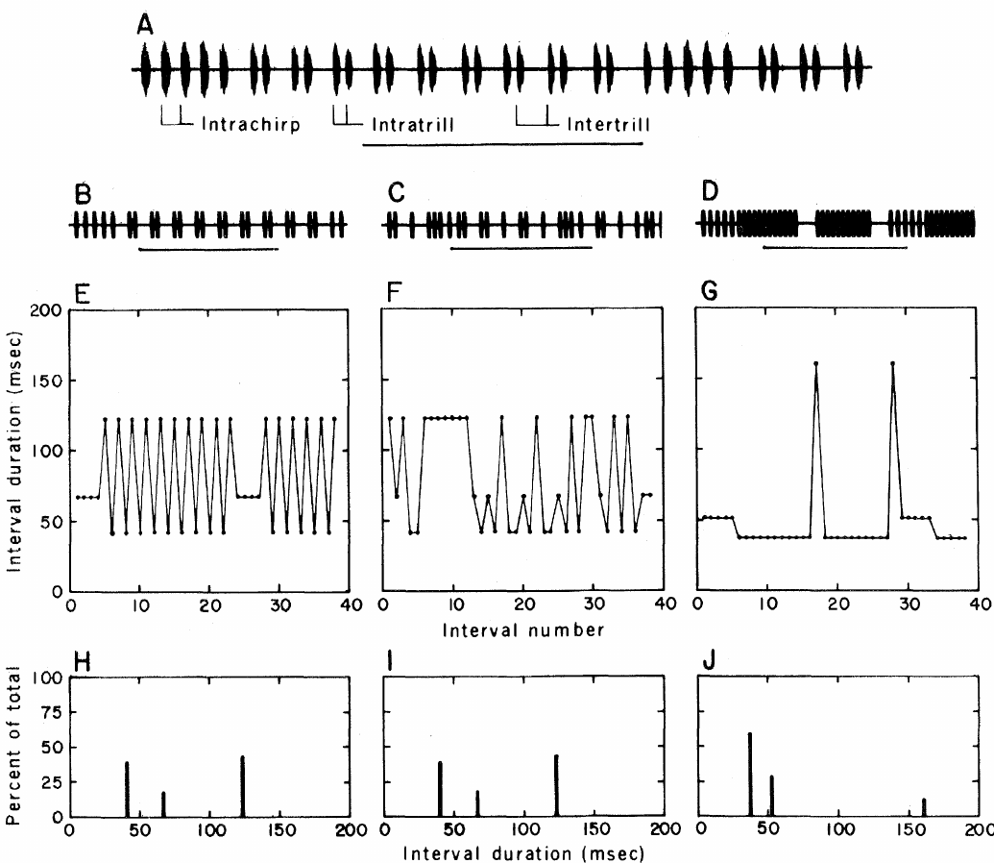
Temporal recognition can be isolated from frequency
Pollack and Hoy synthesized Teleogryllus songs electronically to isolate temporal structure. A pulse period runs from the onset of one pulse to the onset of the next, whereas a pulse interval ordinarily refers to the intervening silence in later cricket studies.
Their models of T. oceanicus and T. commodus song were presented with identical carrier frequencies of 4.5 or 5 kHz. Sound levels were matched within each assay: 65 dB for walking choices and 75 dB for flight steering.
Females preferred their conspecific temporal pattern in both preparations. Thus, frequency differences between the natural species’ songs were unnecessary for that discrimination. The measured preference concerns the tested synthetic patterns and does not imply that frequency is irrelevant to auditory sensitivity or natural mate choice.
Pollack & Hoy (1979), Fig. 1(A–J). Normal, shuffled and heterospecific song intervals.
Pollack & Hoy (1979)
05
Notes:
• Pollack and Hoy synthesized _Teleogryllus_ songs electronically to isolate temporal structure. A **pulse period** runs from the onset of one pulse to the onset of the next, whereas a **pulse interval** ordinarily refers to the intervening silence in later cricket studies.
• Their models of _T. oceanicus_ and _T. commodus_ song were presented with identical carrier frequencies of 4.5 or 5 kHz. Sound levels were matched within each assay: 65 dB for walking choices and 75 dB for flight steering.
• Females preferred their conspecific temporal pattern in both preparations. Thus, frequency differences between the natural species’ songs were unnecessary for that discrimination. The measured preference concerns the tested synthetic patterns and does not imply that frequency is irrelevant to auditory sensitivity or natural mate choice.
• The 1979 figure labels onset-to-onset measurements as interpulse intervals. Keeping that historical definition explicit prevents confusing its intervals with the silent intervals used in the 2015 paired-pulse experiments.
References:
Pollack GS, Hoy RR (1979). Temporal pattern as a cue for species-specific calling song recognition in crickets. Science 204(4391):429–432. https://doi.org/10.1126/science.204.4391.429
Figure: Pollack & Hoy (1979), Fig. 1(A–J). Normal, shuffled and heterospecific song intervals.
Figure source: https://doi.org/10.1126/science.204.4391.429

Slide 6
Shuffling preserves intervals but destroys sequence
A shuffled song retains the durations and relative numbers of the normal song’s onset-to-onset intervals while rearranging their order. Pollack and Hoy used a computer to shuffle the interval sequence repeatedly and synthesize the corresponding sound pulses.
The normal T. oceanicus song included intervals within chirps, within trills and between trills. Its ordered progression disappeared in the shuffled stimulus, but the interval-duration distribution remained. Normal and shuffled models were played at the same 4.5- or 5-kHz carrier.
Females did not consistently discriminate normal from shuffled song in either walking or flight. Recognition therefore need not require an exact ordered copy of the complete normal phrase. The experiment leaves open shorter temporal filters and shared elements between the neural mechanisms of song production and reception.
Pollack & Hoy (1979), Fig. 1(A–J). Normal, shuffled and heterospecific song intervals.
Pollack & Hoy (1979)
06
Notes:
• A **shuffled song** retains the durations and relative numbers of the normal song’s onset-to-onset intervals while rearranging their order. Pollack and Hoy used a computer to shuffle the interval sequence repeatedly and synthesize the corresponding sound pulses.
• The normal _T. oceanicus_ song included intervals within chirps, within trills and between trills. Its ordered progression disappeared in the shuffled stimulus, but the interval-duration distribution remained. Normal and shuffled models were played at the same 4.5- or 5-kHz carrier.
• Females did not consistently discriminate normal from shuffled song in either walking or flight. Recognition therefore need not require an exact ordered copy of the complete normal phrase. The experiment leaves open shorter temporal filters and shared elements between the neural mechanisms of song production and reception.
• A histogram of interval durations can remain unchanged when a sequential interval plot changes markedly. The control isolates order from the availability of individual timing values, rather than comparing a normal song with arbitrary noise.
References:
Pollack GS, Hoy RR (1979). Temporal pattern as a cue for species-specific calling song recognition in crickets. Science 204(4391):429–432. https://doi.org/10.1126/science.204.4391.429
Figure: Pollack & Hoy (1979), Fig. 1(A–J). Normal, shuffled and heterospecific song intervals.
Figure source: https://doi.org/10.1126/science.204.4391.429

Slide 7
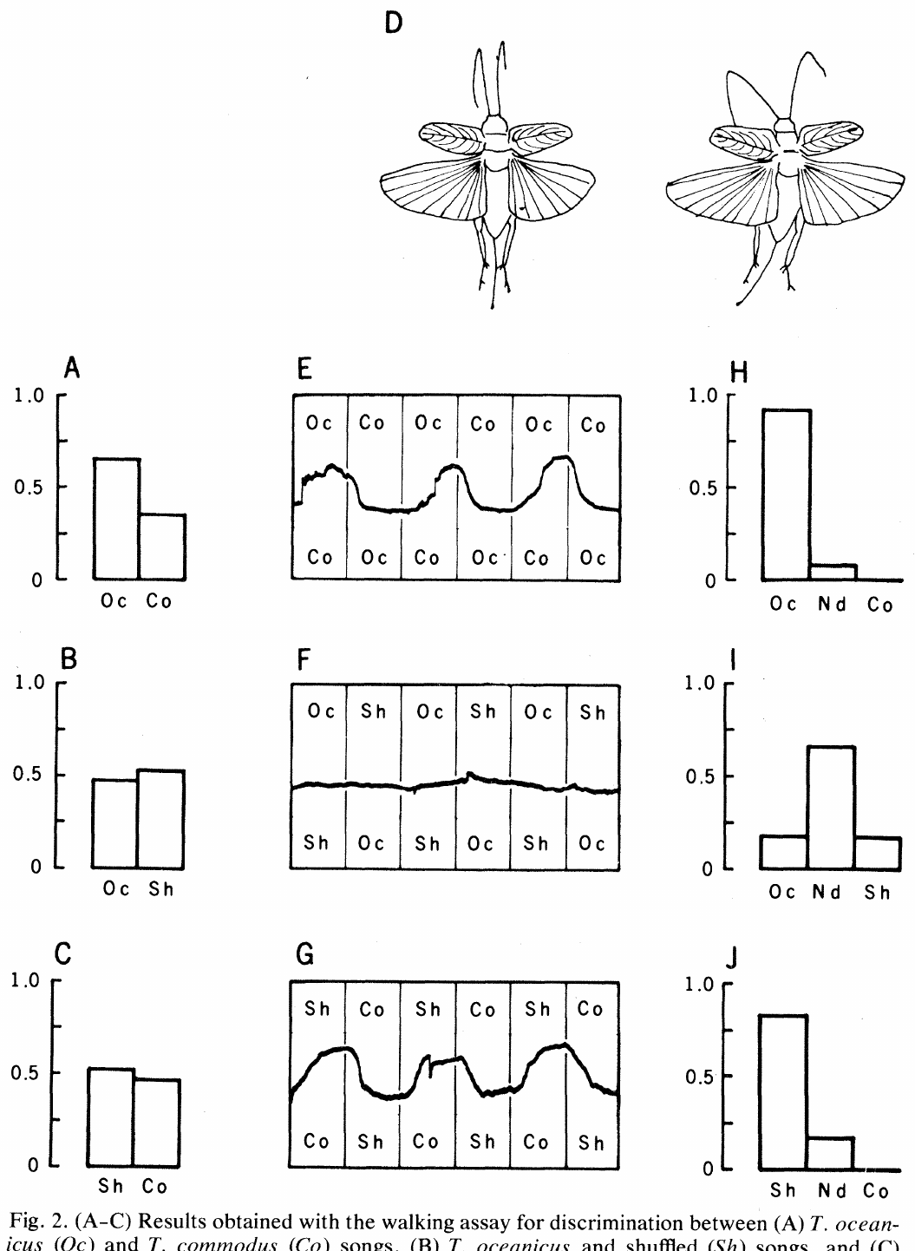
Assay context changes apparent song discrimination
Pollack and Hoy compared a two-speaker walking-choice assay with tethered flight in a wind stream. In flight, movements of the abdomen and hind legs provided a motor correlate of attempted turning, recorded optically while speaker assignments reversed every 30 s.
Normal T. oceanicus song was preferred to T. commodus song in both assays. Shuffled song was preferred to T. commodus song during flight, but the walking assay did not reveal the same discrimination, despite matched song frequencies within each test.
Different motor preparations can yield different expressions of acoustic preference. The authors suggested that flight might detect smaller differences in attractiveness, but did not establish the cause of the discrepancy. Failure to discriminate in one assay is therefore insufficient to conclude that the nervous system cannot distinguish the stimuli.
Pollack & Hoy (1979), Fig. 2(A–J). Walking choices and flight steering.
Pollack & Hoy (1979)
07
Notes:
• Pollack and Hoy compared a two-speaker walking-choice assay with tethered flight in a wind stream. In flight, movements of the abdomen and hind legs provided a motor correlate of attempted turning, recorded optically while speaker assignments reversed every 30 s.
• Normal _T. oceanicus_ song was preferred to _T. commodus_ song in both assays. Shuffled song was preferred to _T. commodus_ song during flight, but the walking assay did not reveal the same discrimination, despite matched song frequencies within each test.
• Different motor preparations can yield different expressions of acoustic preference. The authors suggested that flight might detect smaller differences in attractiveness, but did not establish the cause of the discrepancy. Failure to discriminate in one assay is therefore insufficient to conclude that the nervous system cannot distinguish the stimuli.
• The 65-dB walking and 75-dB flight conditions also differ in stimulus level and behavioral state. The assays provide convergent evidence for temporal recognition but are not interchangeable measures of an identical motor output.
References:
Pollack GS, Hoy RR (1979). Temporal pattern as a cue for species-specific calling song recognition in crickets. Science 204(4391):429–432. https://doi.org/10.1126/science.204.4391.429
Figure: Pollack & Hoy (1979), Fig. 2(A–J). Walking choices and flight steering.
Figure source: https://doi.org/10.1126/science.204.4391.429

Slide 8
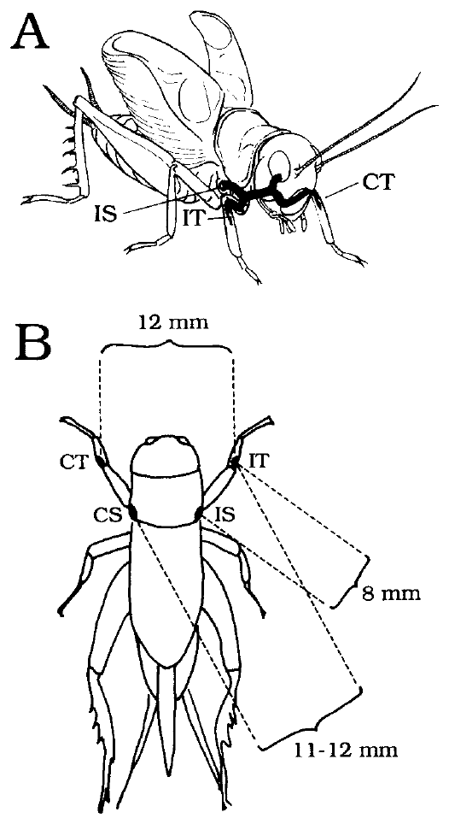
Foreleg ears receive sound through several routes
A cricket’s tympanum is a vibrating membrane in the foreleg tibia. A spiracle is an opening of the tracheal air system; the thoracic acoustic spiracles provide additional routes by which sound reaches the internal surface of each tympanum.
Michelsen and colleagues measured Gryllus bimaculatus ears with laser vibrometry and probe microphones. The original anatomical preparation identifies tympana and spiracles separated by distances of approximately 8–12 mm, far smaller than the wavelength of the calling-song sound.
The ear operates as a pressure-difference receiver: vibration depends on the difference between sound acting on its outer and inner surfaces. Connected air passages permit directional interference before auditory spikes are generated. Their presence alone does not establish useful directionality; transmission amplitude and phase must also be measured.
Michelsen et al. (1994), Fig. 1(A–B). Foreleg ears and acoustic inputs.
Michelsen et al. (1994)
08
Notes:
• A cricket’s **tympanum** is a vibrating membrane in the foreleg tibia. A **spiracle** is an opening of the tracheal air system; the thoracic acoustic spiracles provide additional routes by which sound reaches the internal surface of each tympanum.
• Michelsen and colleagues measured _Gryllus bimaculatus_ ears with laser vibrometry and probe microphones. The original anatomical preparation identifies tympana and spiracles separated by distances of approximately 8–12 mm, far smaller than the wavelength of the calling-song sound.
• The ear operates as a **pressure-difference receiver**: vibration depends on the difference between sound acting on its outer and inner surfaces. Connected air passages permit directional interference before auditory spikes are generated. Their presence alone does not establish useful directionality; transmission amplitude and phase must also be measured.
• Ipsilateral means the same side as the ear under consideration, and contralateral means the opposite side. Each tympanum has an external input plus internal contributions entering through both thoracic spiracles and the other ear.
References:
Michelsen A, Popov AV, Lewis B (1994). Physics of directional hearing in the cricket Gryllus bimaculatus. Journal of Comparative Physiology A 175:153–164. https://doi.org/10.1007/BF00215111
Figure: Michelsen et al. (1994), Fig. 1(A–B). Foreleg ears and acoustic inputs.
Figure source: https://doi.org/10.1007/BF00215111

Slide 9
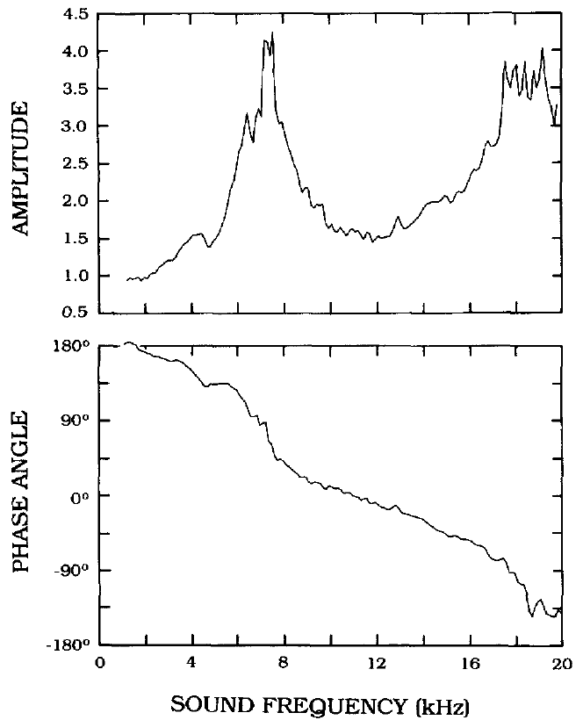
Tracheal transmission changes sound amplitude and phase
Transmission gain describes how strongly a sound component reaches the tympanum through an internal route. Phase describes its position within the sound’s oscillatory cycle. Two components can reinforce or oppose one another depending on both quantities.
Michelsen and colleagues applied local sound at one acoustic input while measuring tympanal vibration. Wax barriers reduced sound at other inputs by at least 20 dB. Ipsilateral-spiracle transmission gain peaked near 4–5 kHz, the calling-song frequency range.
The measured gain and phase specify how an internal sound component combines with the external input. A large internal amplitude does not automatically imply better localization because reinforcement depends on timing. The isolated-input preparation characterizes acoustic transmission rather than intact walking behavior.
Michelsen et al. (1994), Fig. 5. Ipsilateral spiracle transmission gain and phase.
Michelsen et al. (1994), Fig. 1(A–B). Foreleg ears and acoustic inputs.
Michelsen et al. (1994)
09
Notes:
• **Transmission gain** describes how strongly a sound component reaches the tympanum through an internal route. **Phase** describes its position within the sound’s oscillatory cycle. Two components can reinforce or oppose one another depending on both quantities.
• Michelsen and colleagues applied local sound at one acoustic input while measuring tympanal vibration. Wax barriers reduced sound at other inputs by at least 20 dB. Ipsilateral-spiracle transmission gain peaked near 4–5 kHz, the calling-song frequency range.
• The measured gain and phase specify how an internal sound component combines with the external input. A large internal amplitude does not automatically imply better localization because reinforcement depends on timing. The isolated-input preparation characterizes acoustic transmission rather than intact walking behavior.
• The authors first measured the external tympanal transfer function and then used it to estimate the internal-route contribution. Their phase convention accounts for sound pressure acting in opposite directions on the two surfaces of the membrane.
References:
Michelsen A, Popov AV, Lewis B (1994). Physics of directional hearing in the cricket Gryllus bimaculatus. Journal of Comparative Physiology A 175:153–164. https://doi.org/10.1007/BF00215111
Figure: Michelsen et al. (1994), Fig. 5. Ipsilateral spiracle transmission gain and phase.
Figure source: https://doi.org/10.1007/BF00215111
Figure: Michelsen et al. (1994), Fig. 1(A–B). Foreleg ears and acoustic inputs.
Figure source: https://doi.org/10.1007/BF00215111

Slide 10
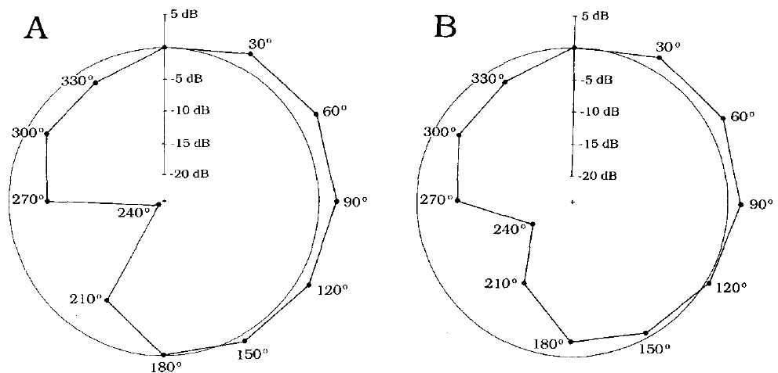
Opposite spiracle input sharpens directionality
For sound arriving from ahead, left and right external inputs differ only slightly because the cricket’s body is small. The contralateral acoustic spiracle supplies an internal component whose phase can convert that modest spatial difference into directional tympanal vibration.
Michelsen and colleagues calculated directional responses from measured input gains and phases. The opposite-spiracle component changed phase by approximately 130–140° as sound direction moved from 0° to 30° off the midline, strongly changing the predicted interference at the ear.
Including both spiracle routes produced forward directional tuning; omitting the contralateral contribution altered that pattern substantially. This supports a mechanical role for cross-body sound transmission. The calculation uses measured acoustics, but it does not identify a behavioral decision rule or establish how central neurons weight the resulting ear signals.
Michelsen et al. (1994), Fig. 11(A–B). Contralateral input changes directional tuning.
Michelsen et al. (1994), Fig. 1(A–B). Foreleg ears and acoustic inputs.
Michelsen et al. (1994)
10
Notes:
• For sound arriving from ahead, left and right external inputs differ only slightly because the cricket’s body is small. The contralateral acoustic spiracle supplies an internal component whose phase can convert that modest spatial difference into directional tympanal vibration.
• Michelsen and colleagues calculated directional responses from measured input gains and phases. The opposite-spiracle component changed phase by approximately 130–140° as sound direction moved from 0° to 30° off the midline, strongly changing the predicted interference at the ear.
• Including both spiracle routes produced forward directional tuning; omitting the contralateral contribution altered that pattern substantially. This supports a mechanical role for cross-body sound transmission. The calculation uses measured acoustics, but it does not identify a behavioral decision rule or establish how central neurons weight the resulting ear signals.
• The contralateral tympanum made a smaller contribution than the contralateral spiracle in this preparation. Treating all cross-body routes as equally important would lose the experimental distinction between their measured transmission gains.
References:
Michelsen A, Popov AV, Lewis B (1994). Physics of directional hearing in the cricket Gryllus bimaculatus. Journal of Comparative Physiology A 175:153–164. https://doi.org/10.1007/BF00215111
Figure: Michelsen et al. (1994), Fig. 11(A–B). Contralateral input changes directional tuning.
Figure source: https://doi.org/10.1007/BF00215111
Figure: Michelsen et al. (1994), Fig. 1(A–B). Foreleg ears and acoustic inputs.
Figure source: https://doi.org/10.1007/BF00215111

Slide 11
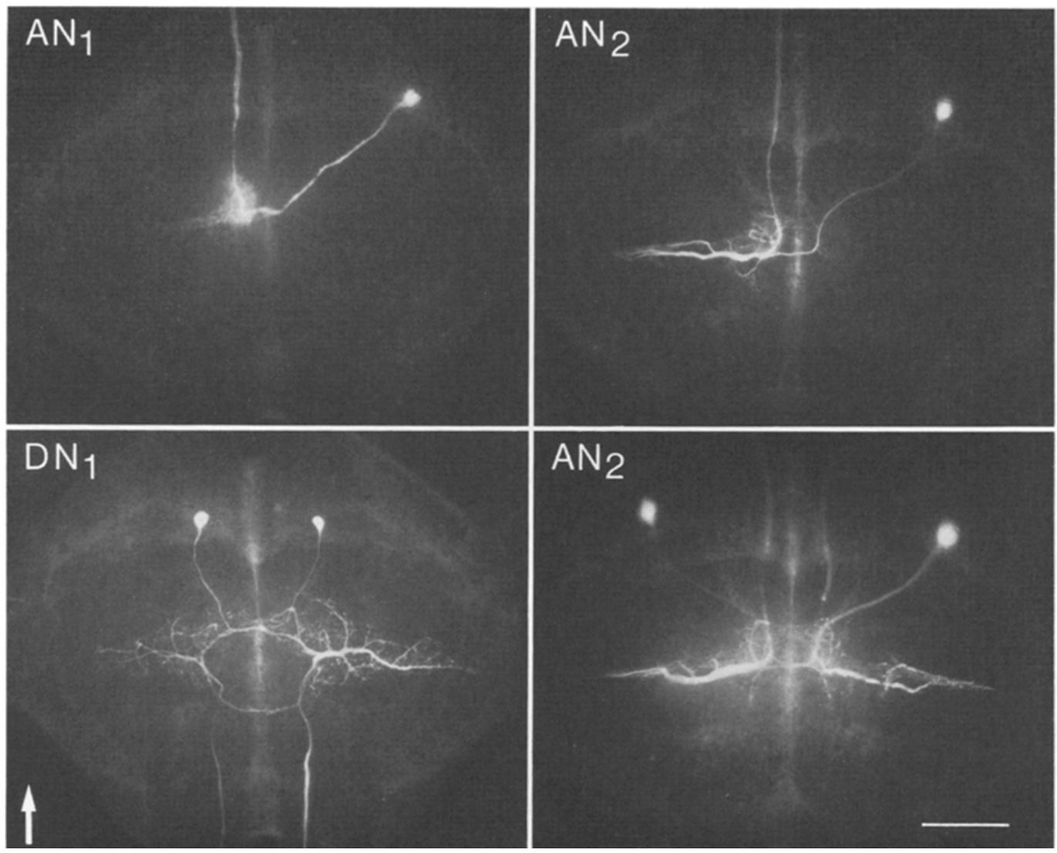
Thoracic auditory cells occupy distinct anatomical routes
The prothoracic ganglion is the segmental neural center associated with the first thoracic segment and forelegs. Auditory sensory axons terminate in its auditory neuropil, a region containing interacting neuronal branches rather than a collection of cell bodies alone.
Wohlers and Huber recorded individual neurons in female Gryllus campestris and filled them with Lucifer dye. Stimuli covered 2–20 kHz, and filled processes were examined after recording to connect a cell’s acoustic responses with its anatomical projection.
Ascending neurons carried signals toward the head, whereas local omega neurons remained within the thoracic ganglion. The fluorescent micrographs establish identified routes for early auditory processing. Dye labeling reveals morphology, but overlapping branches alone do not prove a functional synapse or its transmitter identity.
Wohlers & Huber (1982), Fig. 1. Dye-labeled auditory interneurons.
Wohlers & Huber (1982)
11
Notes:
• The **prothoracic ganglion** is the segmental neural center associated with the first thoracic segment and forelegs. Auditory sensory axons terminate in its auditory **neuropil**, a region containing interacting neuronal branches rather than a collection of cell bodies alone.
• Wohlers and Huber recorded individual neurons in female _Gryllus campestris_ and filled them with Lucifer dye. Stimuli covered 2–20 kHz, and filled processes were examined after recording to connect a cell’s acoustic responses with its anatomical projection.
• Ascending neurons carried signals toward the head, whereas local omega neurons remained within the thoracic ganglion. The fluorescent micrographs establish identified routes for early auditory processing. Dye labeling reveals morphology, but overlapping branches alone do not prove a functional synapse or its transmitter identity.
• The source reports a 200-μm calibration for the labeled material. Anatomical identity allows responses from repeated preparations to be attributed to a named cell type rather than grouped only by their firing pattern.
References:
Wohlers DW, Huber F (1982). Processing of sound signals by six types of neurons in the prothoracic ganglion of the cricket, Gryllus campestris L. Journal of Comparative Physiology A 146:161–173. https://doi.org/10.1007/BF00610234
Figure: Wohlers & Huber (1982), Fig. 1. Dye-labeled auditory interneurons.
Figure source: https://doi.org/10.1007/BF00610234

Slide 12
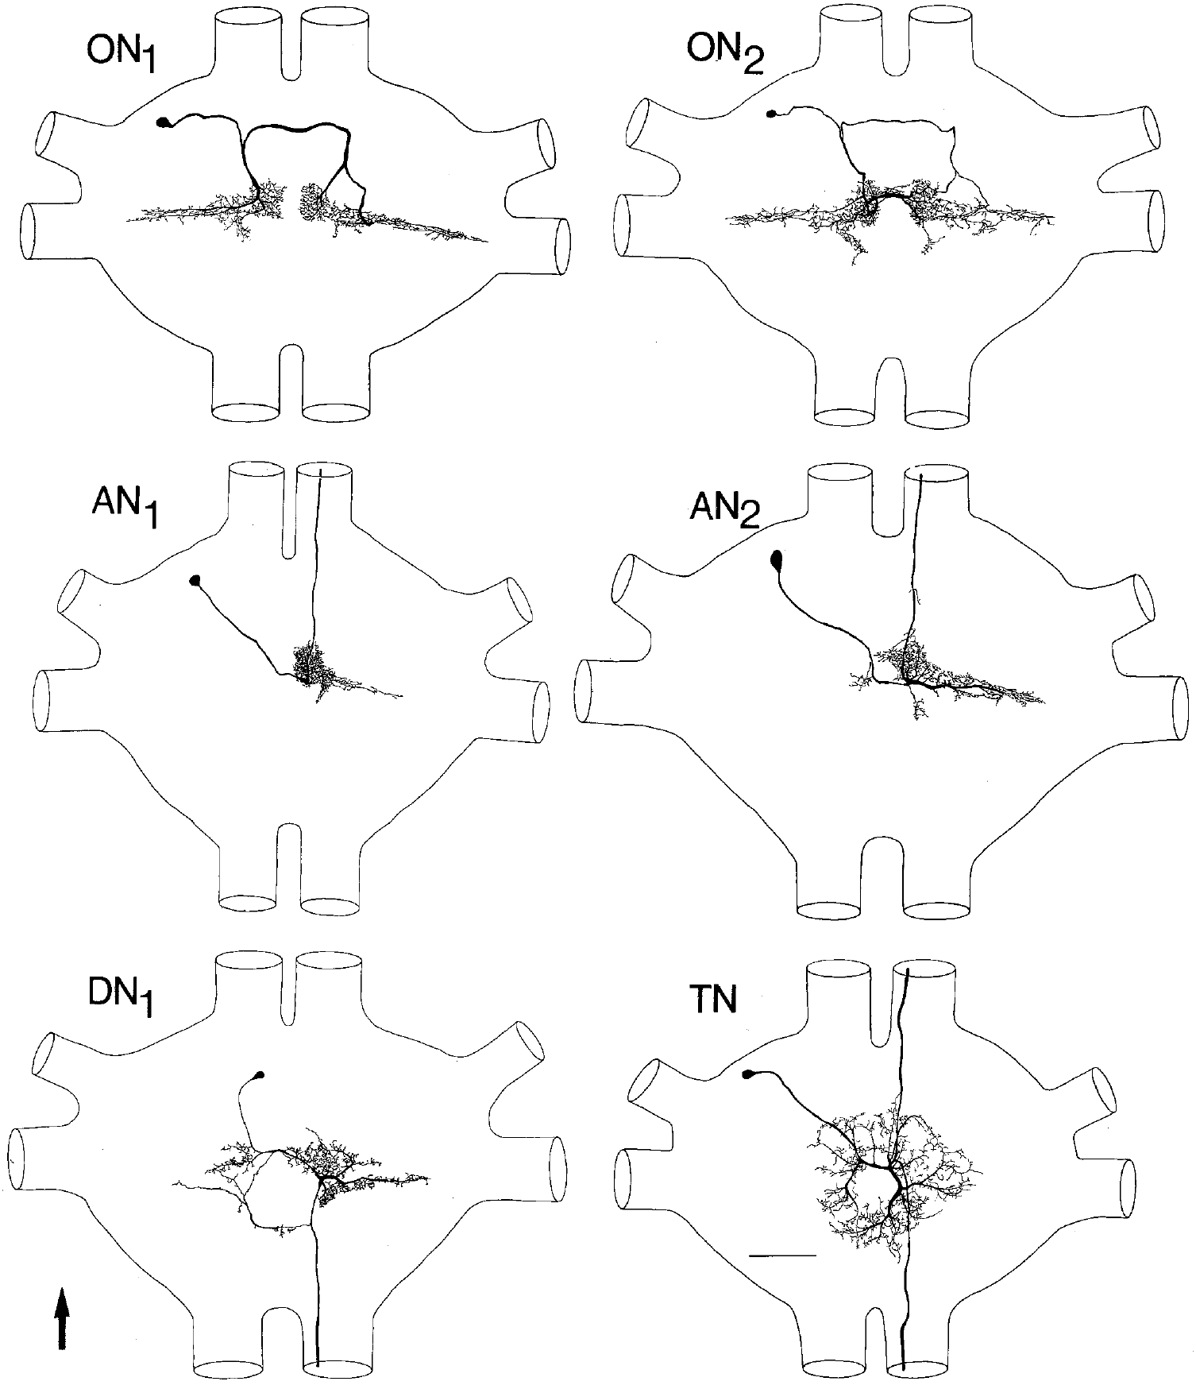
Six cell types distribute early auditory information
Wohlers and Huber identified six types of auditory interneuron arranged as bilateral mirror-image pairs. An interneuron receives and processes neuronal inputs rather than directly serving as a sensory receptor or the final motor neuron supplying a muscle.
ON1 and ON2 had omega-shaped local branches; AN1 and AN2 projected upward toward the brain; DN1 projected downward; and TN had both ascending and descending branches. Their responses were characterized with synthetic chirps and 2–20-kHz stimulation under separate-ear conditions.
These routes permit local comparisons and transmission of acoustic information to different neural centers. The authors’ anatomical reconstructions distinguish projection patterns but do not assign each neuron a unique behavioral function. A neuron that responds to calling song is not necessarily the cell that recognizes its species-specific rhythm.
Wohlers & Huber (1982), Fig. 2. Six identified neuron types.
Wohlers & Huber (1982)
12
Notes:
• Wohlers and Huber identified six types of auditory interneuron arranged as bilateral mirror-image pairs. An **interneuron** receives and processes neuronal inputs rather than directly serving as a sensory receptor or the final motor neuron supplying a muscle.
• ON1 and ON2 had omega-shaped local branches; AN1 and AN2 projected upward toward the brain; DN1 projected downward; and TN had both ascending and descending branches. Their responses were characterized with synthetic chirps and 2–20-kHz stimulation under separate-ear conditions.
• These routes permit local comparisons and transmission of acoustic information to different neural centers. The authors’ anatomical reconstructions distinguish projection patterns but do not assign each neuron a unique behavioral function. A neuron that responds to calling song is not necessarily the cell that recognizes its species-specific rhythm.
• Names describe identified anatomical classes, and the side of a cell body must be distinguished from the side supplying excitation. The reconstructions preserve the original common scale so their branching patterns can be compared directly.
References:
Wohlers DW, Huber F (1982). Processing of sound signals by six types of neurons in the prothoracic ganglion of the cricket, Gryllus campestris L. Journal of Comparative Physiology A 146:161–173. https://doi.org/10.1007/BF00610234
Figure: Wohlers & Huber (1982), Fig. 2. Six identified neuron types.
Figure source: https://doi.org/10.1007/BF00610234

Slide 13
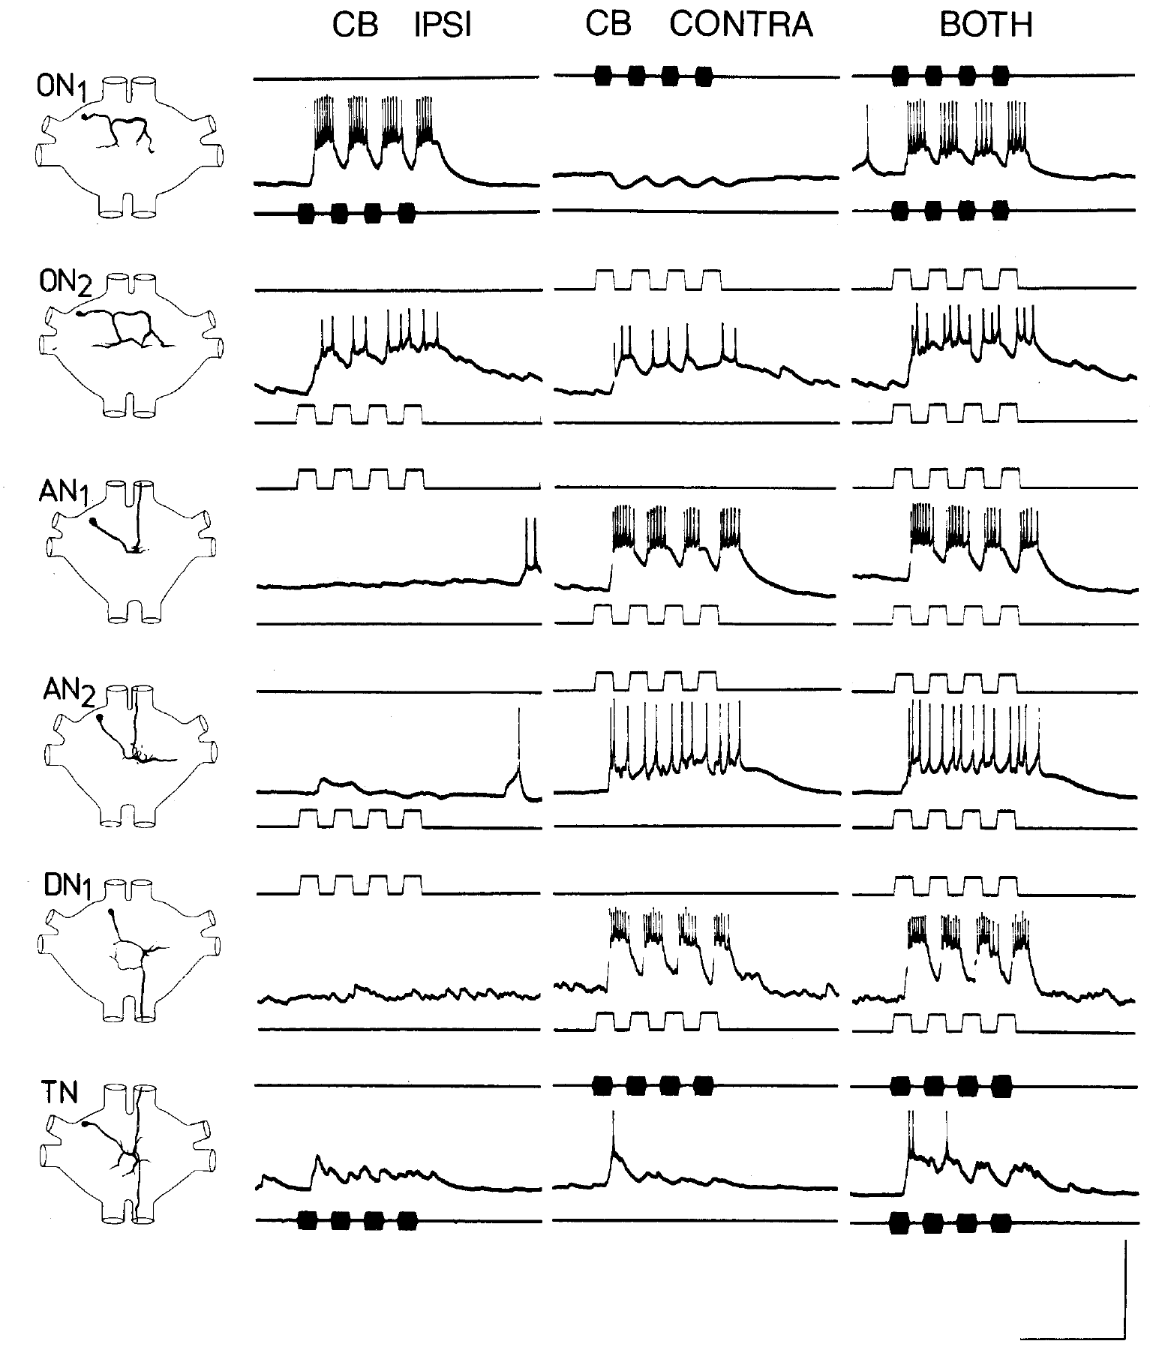
ON1 combines excitation with opposite inhibition
Excitation increases a neuron’s tendency to fire, whereas inhibition reduces that tendency through synaptic effects on its membrane potential or conductance. In ON1, the ear on the cell-body side supplies excitation and the opposite ear supplies inhibition.
Wohlers and Huber separated the ears acoustically with legphones, cut the connecting trachea and sealed thoracic spiracles. Four-pulse calling-song stimuli at 4.5 kHz were presented to each ear alone and then together while recording intracellularly from identified cells.
ON1’s response to bilateral stimulation reflects interacting neural inputs rather than acoustic cross-talk alone. This configuration supports an early neural comparison between sides. It establishes the signs of the recorded responses, but does not by itself determine which other cell supplies the inhibition or which receptor mediates it.
Wohlers & Huber (1982), Fig. 6. Separate-ear and bilateral stimulation.
Wohlers & Huber (1982)
13
Notes:
• **Excitation** increases a neuron’s tendency to fire, whereas **inhibition** reduces that tendency through synaptic effects on its membrane potential or conductance. In ON1, the ear on the cell-body side supplies excitation and the opposite ear supplies inhibition.
• Wohlers and Huber separated the ears acoustically with legphones, cut the connecting trachea and sealed thoracic spiracles. Four-pulse calling-song stimuli at 4.5 kHz were presented to each ear alone and then together while recording intracellularly from identified cells.
• ON1’s response to bilateral stimulation reflects interacting neural inputs rather than acoustic cross-talk alone. This configuration supports an early neural comparison between sides. It establishes the signs of the recorded responses, but does not by itself determine which other cell supplies the inhibition or which receptor mediates it.
• Monaural stimulation activates one ear, whereas binaural stimulation activates both. The isolated-ear controls remove much of the peripheral acoustic interaction so that differences in membrane response can be attributed more securely to central processing.
References:
Wohlers DW, Huber F (1982). Processing of sound signals by six types of neurons in the prothoracic ganglion of the cricket, Gryllus campestris L. Journal of Comparative Physiology A 146:161–173. https://doi.org/10.1007/BF00610234
Figure: Wohlers & Huber (1982), Fig. 6. Separate-ear and bilateral stimulation.
Figure source: https://doi.org/10.1007/BF00610234

Slide 14
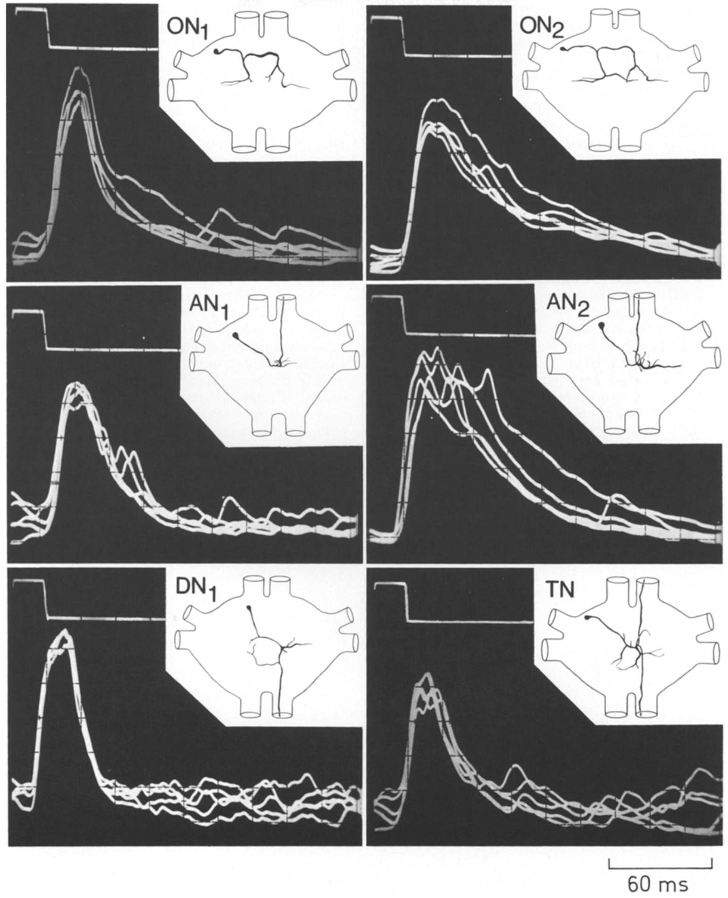
AN1 copies pulses without recognizing the pattern
AN1, the first ascending auditory neuron, carries calling-song information from thoracic neuropil toward the brain. Its excitatory response is driven predominantly by the ear opposite its cell body, a laterality convention that differs from the excitatory side of ON1.
Wohlers and Huber recorded responses to 1-syllable chirps across sound frequencies. A 20-ms pulse near 4.5 kHz produced excitation, and AN1 followed the pulse-and-pause structure of calling-song patterns more accurately than several other thoracic neurons.
Accurate copying makes AN1 a useful input to later temporal processing, but copying is distinct from selectivity. The thoracic cell continued responding to patterns outside the behaviorally preferred interval range. Its spikes represent available sound events without establishing that the cricket has accepted those events as a conspecific song.
Wohlers & Huber (1982), Fig. 4. Intracellular responses and neuron shapes.
Wohlers & Huber (1982)
14
Notes:
• **AN1**, the first ascending auditory neuron, carries calling-song information from thoracic neuropil toward the brain. Its excitatory response is driven predominantly by the ear opposite its cell body, a laterality convention that differs from the excitatory side of ON1.
• Wohlers and Huber recorded responses to 1-syllable chirps across sound frequencies. A 20-ms pulse near 4.5 kHz produced excitation, and AN1 followed the pulse-and-pause structure of calling-song patterns more accurately than several other thoracic neurons.
• Accurate copying makes AN1 a useful input to later temporal processing, but copying is distinct from selectivity. The thoracic cell continued responding to patterns outside the behaviorally preferred interval range. Its spikes represent available sound events without establishing that the cricket has accepted those events as a conspecific song.
• An excitatory postsynaptic potential, or EPSP, is a membrane depolarization produced by synaptic input. Multiple EPSPs can sum until the spike threshold is crossed; the voltage recordings and neuronal reconstructions distinguish that integration from the final spike train.
References:
Wohlers DW, Huber F (1982). Processing of sound signals by six types of neurons in the prothoracic ganglion of the cricket, Gryllus campestris L. Journal of Comparative Physiology A 146:161–173. https://doi.org/10.1007/BF00610234
Figure: Wohlers & Huber (1982), Fig. 4. Intracellular responses and neuron shapes.
Figure source: https://doi.org/10.1007/BF00610234

Slide 15
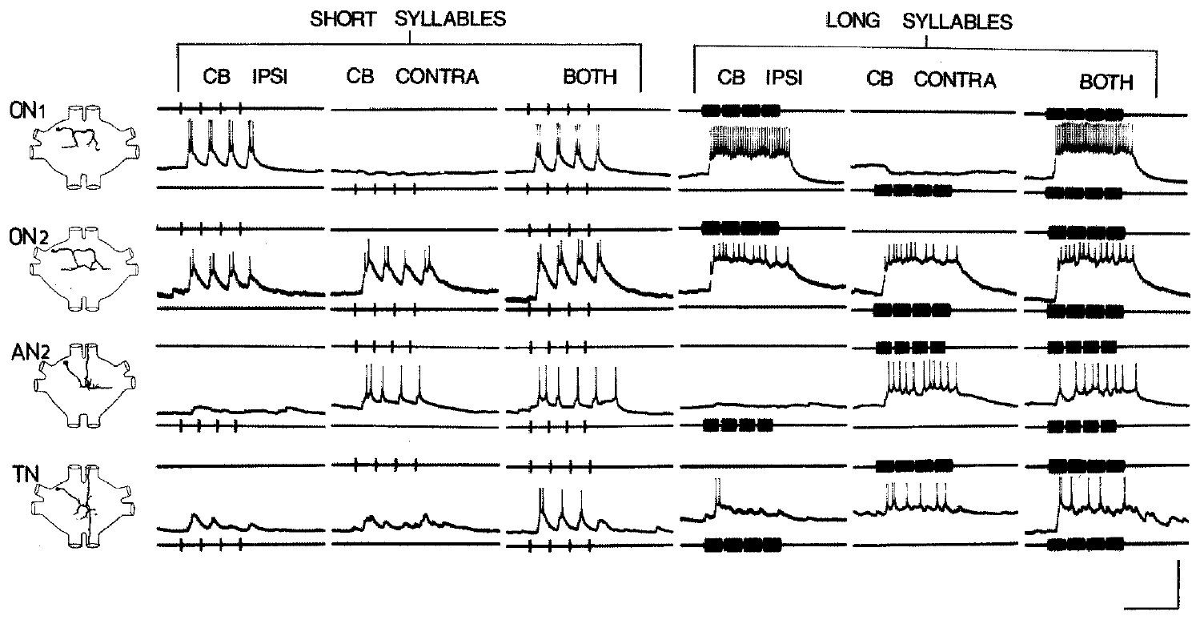
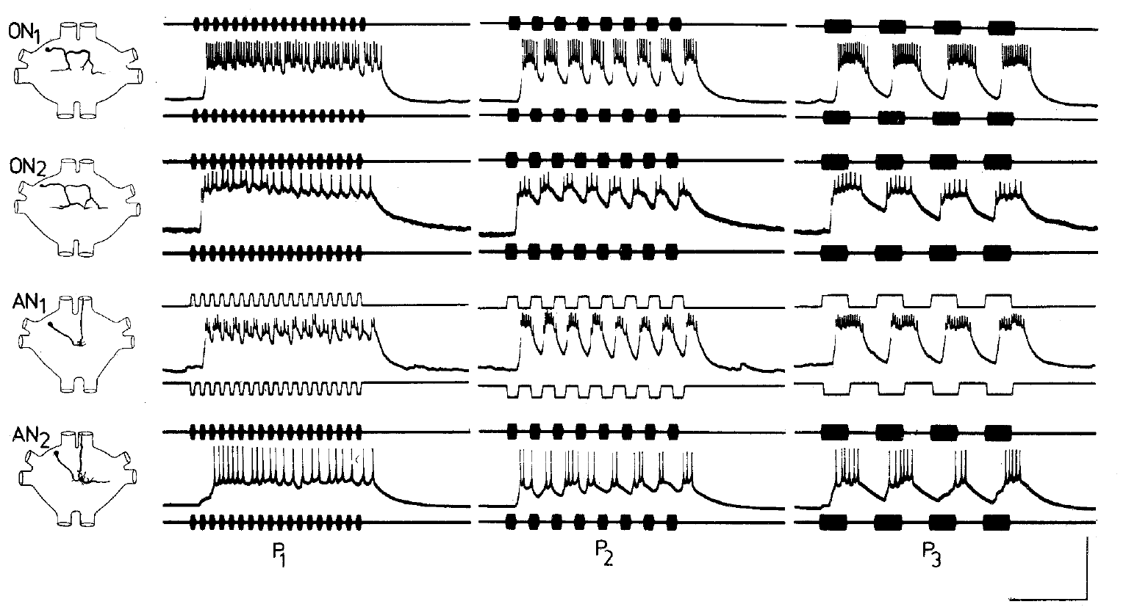
Thoracic resolution exceeds recognition selectivity
Temporal resolution is the ability of a response to preserve separate sound events. It differs from temporal preference, which requires a stronger response to particular timing values. A neuron may resolve many pulse patterns without favoring the species-specific pattern.
Wohlers and Huber tested 2.5-ms syllables and progressively shorter pauses. The six thoracic neuron types could copy those brief pulses, but none reliably copied pauses shorter than 5 ms. Equal-duration syllable and pause patterns were also tested over different repetition periods.
Behavior was preferentially elicited by approximately 20–60-ms silent intervals in the compared conditions, yet the recorded thoracic cells were not specifically tuned to that entire range. The difference places a recognition problem downstream of simple event copying. It does not exclude contributions from thoracic timing or adaptation to the later computation.
Wohlers & Huber (1982), Fig. 8. Responses to short and long syllables.
Wohlers & Huber (1982), Fig. 9. Responses to varied syllable periods.
Wohlers & Huber (1982)
15
Notes:
• **Temporal resolution** is the ability of a response to preserve separate sound events. It differs from temporal preference, which requires a stronger response to particular timing values. A neuron may resolve many pulse patterns without favoring the species-specific pattern.
• Wohlers and Huber tested 2.5-ms syllables and progressively shorter pauses. The six thoracic neuron types could copy those brief pulses, but none reliably copied pauses shorter than 5 ms. Equal-duration syllable and pause patterns were also tested over different repetition periods.
• Behavior was preferentially elicited by approximately 20–60-ms silent intervals in the compared conditions, yet the recorded thoracic cells were not specifically tuned to that entire range. The difference places a recognition problem downstream of simple event copying. It does not exclude contributions from thoracic timing or adaptation to the later computation.
• The original neuronal stimuli and the cited behavioral comparison must not be confused with the pulse-period optimum measured in Gryllus bimaculatus in 2012. Species, stimulus definitions and duty cycle differ across these experiments.
References:
Wohlers DW, Huber F (1982). Processing of sound signals by six types of neurons in the prothoracic ganglion of the cricket, Gryllus campestris L. Journal of Comparative Physiology A 146:161–173. https://doi.org/10.1007/BF00610234
Figure: Wohlers & Huber (1982), Fig. 8. Responses to short and long syllables.
Figure source: https://doi.org/10.1007/BF00610234
Figure: Wohlers & Huber (1982), Fig. 9. Responses to varied syllable periods.
Figure source: https://doi.org/10.1007/BF00610234

Slide 16
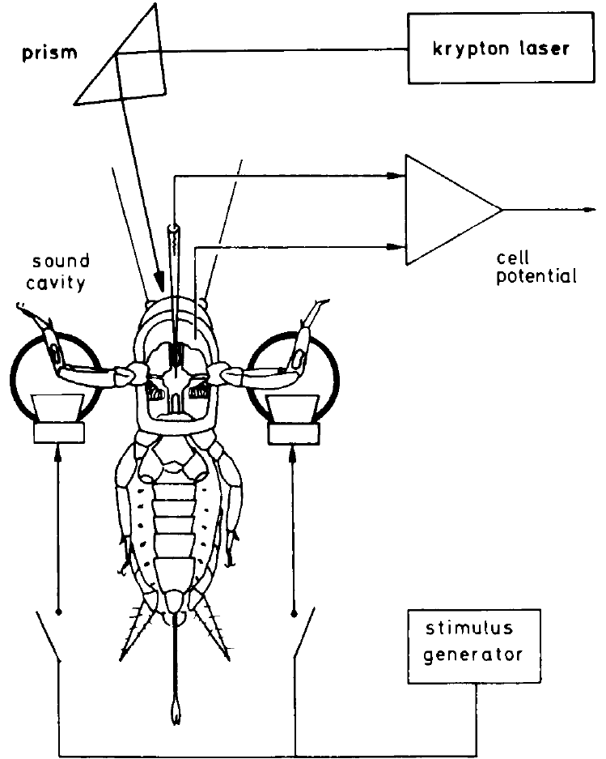
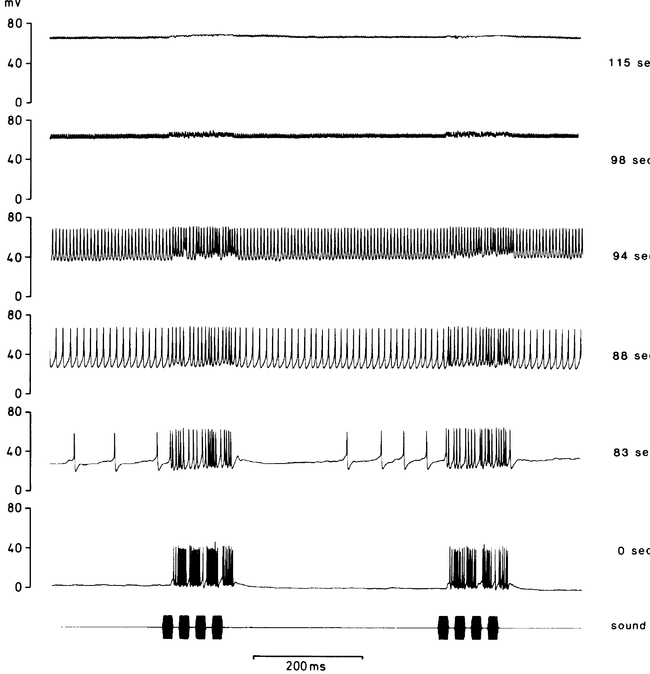
Photoinactivation tests a cell’s causal role
Photoinactivation selectively damages a dye-filled neuron by illuminating the preparation with intense light. Selverston and colleagues filled an identified auditory interneuron with Lucifer Yellow, then tested whether its loss changed the responses of another cell.
Female Gryllus bimaculatus received separate-ear, 5-kHz chirps through legphones. Laser irradiation at 5–50 mW progressively depolarized the stained neuron and abolished its activity. The acoustic preparation reduced cross-talk between ears by as much as 60 dB.
Comparing responses before and after loss provides causal evidence beyond anatomical overlap. A changed postsynaptic response can identify a required source of inhibition, provided the preparation remains functional. The method removes a cell’s influence rather than selectively blocking one transmitter receptor or distinguishing every synapse that cell makes.
Selverston et al. (1985), Fig. 2. Loss of activity during irradiation.
Selverston et al. (1985), Fig. 1. Legphones and selective photoinactivation.
Selverston et al. (1985)
16
Notes:
• **Photoinactivation** selectively damages a dye-filled neuron by illuminating the preparation with intense light. Selverston and colleagues filled an identified auditory interneuron with Lucifer Yellow, then tested whether its loss changed the responses of another cell.
• Female _Gryllus bimaculatus_ received separate-ear, 5-kHz chirps through legphones. Laser irradiation at 5–50 mW progressively depolarized the stained neuron and abolished its activity. The acoustic preparation reduced cross-talk between ears by as much as 60 dB.
• Comparing responses before and after loss provides causal evidence beyond anatomical overlap. A changed postsynaptic response can identify a required source of inhibition, provided the preparation remains functional. The method removes a cell’s influence rather than selectively blocking one transmitter receptor or distinguishing every synapse that cell makes.
• Ablation experiments are strongest when the surviving neuron retains excitation to its usual input. Preserved responses constrain the possibility that irradiation merely destroyed the entire auditory preparation.
References:
Selverston AI, Kleindienst HU, Huber F (1985). Synaptic connectivity between cricket auditory interneurons as studied by selective photoinactivation. Journal of Neuroscience 5(5):1283–1292. https://doi.org/10.1523/JNEUROSCI.05-05-01283.1985
Figure: Selverston et al. (1985), Fig. 1. Legphones and selective photoinactivation.
Figure source: https://doi.org/10.1523/JNEUROSCI.05-05-01283.1985
Figure: Selverston et al. (1985), Fig. 2. Loss of activity during irradiation.
Figure source: https://doi.org/10.1523/JNEUROSCI.05-05-01283.1985

Slide 17
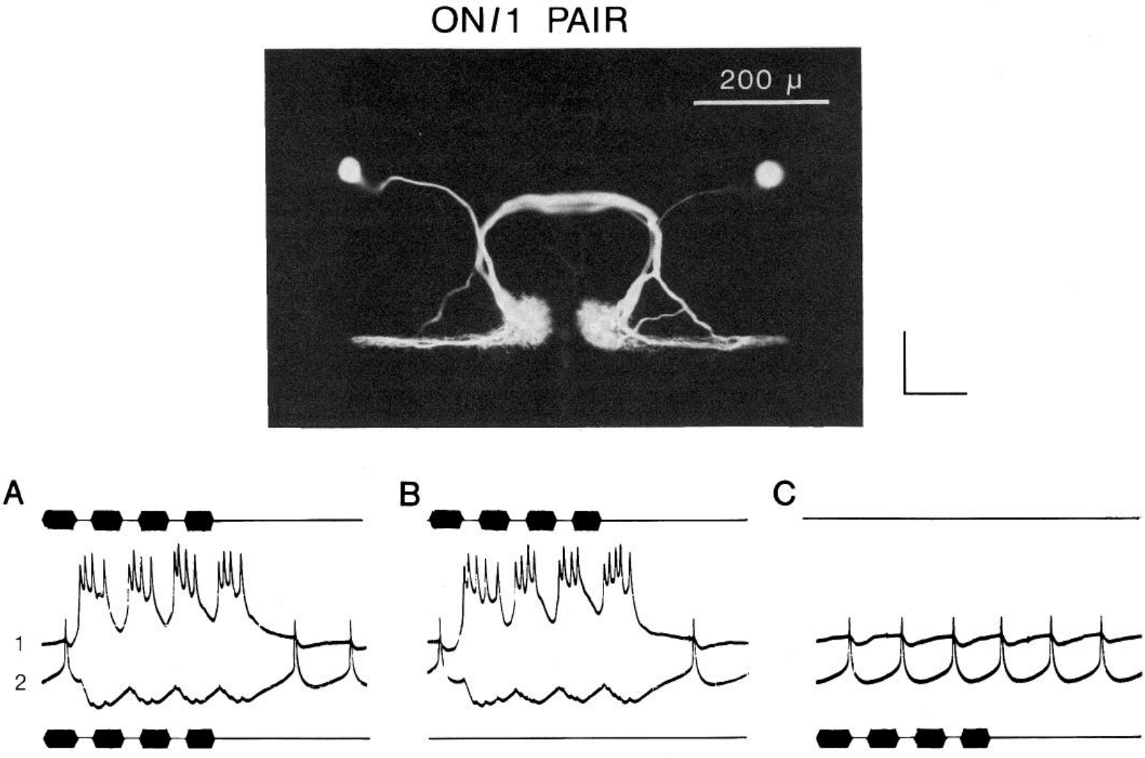
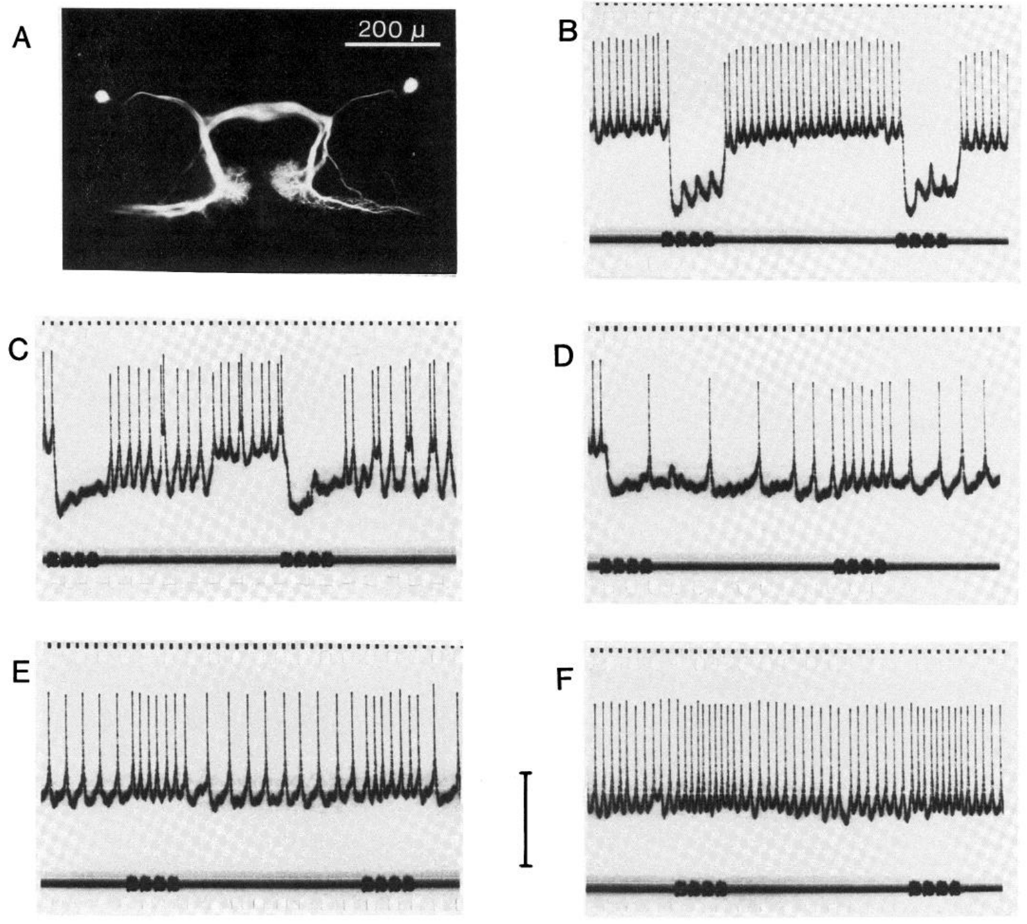
Omega cells provide reciprocal inhibition
Reciprocal inhibition means that each member of a neuronal pair inhibits the other. Selverston and colleagues combined simultaneous intracellular recording from paired ON1 cells with selective photoinactivation to test that organization directly.
Separate-ear, 5-kHz stimulation excited the corresponding ON1 and suppressed activity in its partner. After one stained ON1 was inactivated, the surviving cell lost its strong opposite-ear inhibitory response and a weak excitatory response became apparent.
The paired recordings and ablation support ON1 as a source of reciprocal suppression, sharpening the contrast between competing auditory inputs. The unmasked excitation means the opposite-ear pathway is not purely inhibitory. These recordings do not establish the chemical transmitter or show that ON1 alone is sufficient for phonotactic steering.
Selverston et al. (1985), Fig. 4. Paired ON1 recordings.
Selverston et al. (1985), Fig. 7(A–F). ON1 ablation removes opposite-ear inhibition.
Selverston et al. (1985)
17
Notes:
• **Reciprocal inhibition** means that each member of a neuronal pair inhibits the other. Selverston and colleagues combined simultaneous intracellular recording from paired ON1 cells with selective photoinactivation to test that organization directly.
• Separate-ear, 5-kHz stimulation excited the corresponding ON1 and suppressed activity in its partner. After one stained ON1 was inactivated, the surviving cell lost its strong opposite-ear inhibitory response and a weak excitatory response became apparent.
• The paired recordings and ablation support ON1 as a source of reciprocal suppression, sharpening the contrast between competing auditory inputs. The unmasked excitation means the opposite-ear pathway is not purely inhibitory. These recordings do not establish the chemical transmitter or show that ON1 alone is sufficient for phonotactic steering.
• Removing inhibition reveals input that was previously obscured by the combined response. That finding separates the existence of a weak excitatory route from the dominance of reciprocal inhibition in the intact circuit.
References:
Selverston AI, Kleindienst HU, Huber F (1985). Synaptic connectivity between cricket auditory interneurons as studied by selective photoinactivation. Journal of Neuroscience 5(5):1283–1292. https://doi.org/10.1523/JNEUROSCI.05-05-01283.1985
Figure: Selverston et al. (1985), Fig. 4. Paired ON1 recordings.
Figure source: https://doi.org/10.1523/JNEUROSCI.05-05-01283.1985
Figure: Selverston et al. (1985), Fig. 7(A–F). ON1 ablation removes opposite-ear inhibition.
Figure source: https://doi.org/10.1523/JNEUROSCI.05-05-01283.1985

Slide 18
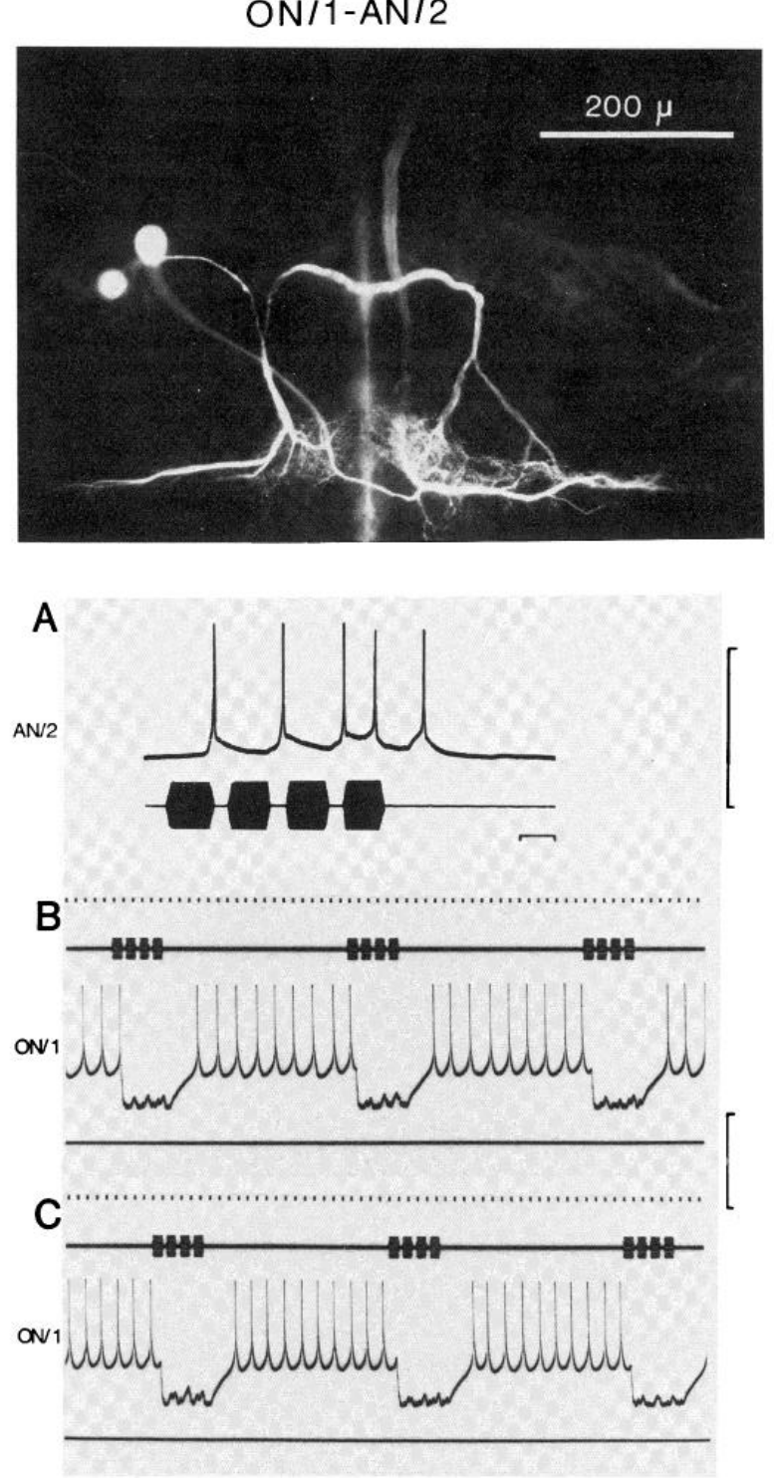
ON1 also supplies inhibition to an ascending cell
AN2 is an ascending auditory interneuron distinct from the calling-song pathway AN1. In the photoinactivation experiments, its response combined strong excitation from one ear with inhibition from stimulation on the cell-body side.
Selverston and colleagues recorded AN2 during separate-ear, 5-kHz chirps before and after damaging the ipsilateral ON1. The previously inhibitory response was replaced by weak excitation, while the neuron’s other acoustic responses could still be recorded.
This intervention identifies ON1 as a source of AN2 inhibition and supports a network in which local thoracic cells regulate ascending output. It does not justify assigning the same connectivity to every ascending cell. In particular, an experimentally demonstrated ON1–AN2 interaction must not be relabeled as an ON1–AN1 synapse.
Selverston et al. (1985), Fig. 11(A–C). ON1 ablation removes AN2 inhibition.
Selverston et al. (1985)
18
Notes:
• **AN2** is an ascending auditory interneuron distinct from the calling-song pathway AN1. In the photoinactivation experiments, its response combined strong excitation from one ear with inhibition from stimulation on the cell-body side.
• Selverston and colleagues recorded AN2 during separate-ear, 5-kHz chirps before and after damaging the ipsilateral ON1. The previously inhibitory response was replaced by weak excitation, while the neuron’s other acoustic responses could still be recorded.
• This intervention identifies ON1 as a source of AN2 inhibition and supports a network in which local thoracic cells regulate ascending output. It does not justify assigning the same connectivity to every ascending cell. In particular, an experimentally demonstrated ON1–AN2 interaction must not be relabeled as an ON1–AN1 synapse.
• AN2 and AN1 are anatomically and physiologically distinct identified neurons. The inference concerns the cell tested and the stimulus frequency used; it is not a complete connectome of the cricket auditory ganglion.
References:
Selverston AI, Kleindienst HU, Huber F (1985). Synaptic connectivity between cricket auditory interneurons as studied by selective photoinactivation. Journal of Neuroscience 5(5):1283–1292. https://doi.org/10.1523/JNEUROSCI.05-05-01283.1985
Figure: Selverston et al. (1985), Fig. 11(A–C). ON1 ablation removes AN2 inhibition.
Figure source: https://doi.org/10.1523/JNEUROSCI.05-05-01283.1985

Slide 19
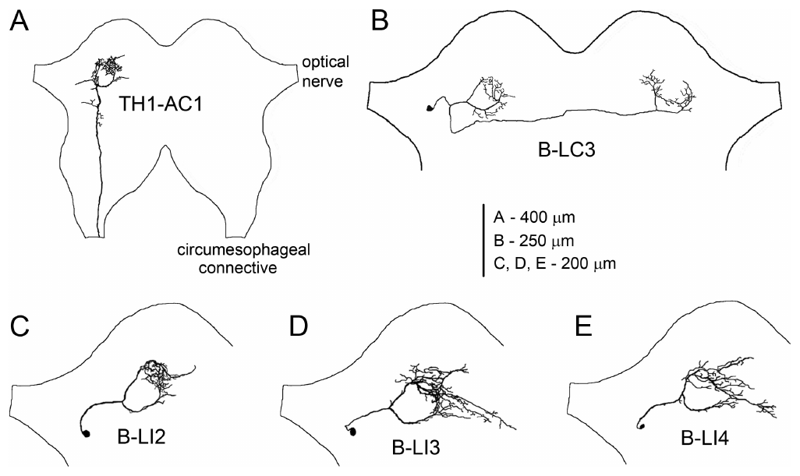
Brain neurons branch near AN1 terminals
The anterior protocerebrum is a front region of the cricket brain containing terminals of the ascending auditory pathway. Kostarakos and Hedwig identified local brain cells whose ring-like branches overlapped that termination area in female Gryllus bimaculatus.
Intracellular recordings were followed by dye labeling while synthetic 4.8-kHz chirps varied in duration, interval and period. Their labels B-LI2, B-LI3 and B-LI4 correspond to LN2, LN3 and LN4 in the later circuit study; B-LC3 connected the auditory regions across the midline.
Different response selectivities occurred among cells occupying the same local region. The anatomy supports a compact substrate for processing temporal patterns, while the recorded tuning distinguishes information copying from recognition-related filtering. Branch overlap is evidence of proximity, not direct proof of every proposed synaptic connection.
Kostarakos & Hedwig (2012), Fig. 1(A–E). Ascending and local brain neurons.
Kostarakos & Hedwig (2012), Fig. 6. Published behavior and neuronal response heat maps.
Kostarakos & Hedwig (2012)
19
Notes:
• The **anterior protocerebrum** is a front region of the cricket brain containing terminals of the ascending auditory pathway. Kostarakos and Hedwig identified local brain cells whose ring-like branches overlapped that termination area in female _Gryllus bimaculatus_.
• Intracellular recordings were followed by dye labeling while synthetic 4.8-kHz chirps varied in duration, interval and period. Their labels B-LI2, B-LI3 and B-LI4 correspond to LN2, LN3 and LN4 in the later circuit study; B-LC3 connected the auditory regions across the midline.
• Different response selectivities occurred among cells occupying the same local region. The anatomy supports a compact substrate for processing temporal patterns, while the recorded tuning distinguishes information copying from recognition-related filtering. Branch overlap is evidence of proximity, not direct proof of every proposed synaptic connection.
• The B-LC3 commissural projection links auditory processing areas on the two sides. It should not be treated as identical to the later nonspiking LN5, which was newly identified in the 2015 study.
References:
Kostarakos K, Hedwig B (2012). Calling song recognition in female crickets: temporal tuning of identified brain neurons matches behavior. Journal of Neuroscience 32(28):9601–9612. https://doi.org/10.1523/JNEUROSCI.1170-12.2012
Figure: Kostarakos & Hedwig (2012), Fig. 1(A–E). Ascending and local brain neurons.
Figure source: https://doi.org/10.1523/JNEUROSCI.1170-12.2012
Figure: Kostarakos & Hedwig (2012), Fig. 6. Published behavior and neuronal response heat maps.
Figure source: https://doi.org/10.1523/JNEUROSCI.1170-12.2012

Slide 20
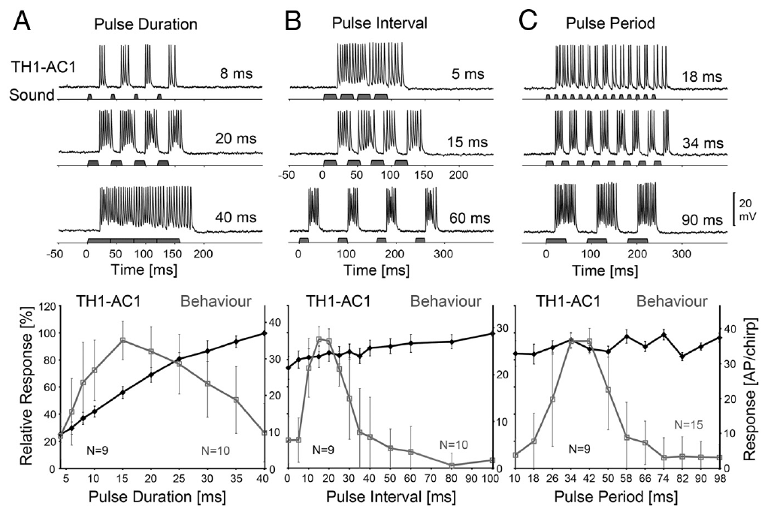
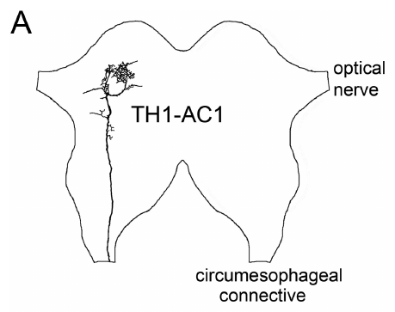
AN1 spike count does not encode attractiveness
An action potential is a brief regenerative electrical spike that can transmit activity along an axon. Kostarakos and Hedwig counted AN1 action potentials per chirp and compared them with phonotactic steering elicited by the same temporal stimulus classes.
Increasing pulse duration from 8 to 20 to 40 ms increased AN1 output from approximately 14 to 26 to 37 spikes per chirp. Behavioral attraction instead peaked near 15-ms pulses and decreased toward longer durations under this stimulus paradigm.
The divergence means that total ascending spike count is insufficient to explain female preference. Later processing must distinguish the temporal organization carried by AN1. The comparison supports a transformation of the input representation, but it does not alone identify the necessary synapses or exclude additional ascending contributions under other acoustic conditions.
Kostarakos & Hedwig (2012), Fig. 2(A–C). AN1 activity and behavioral tuning.
Kostarakos & Hedwig (2012), Fig. 1(A). AN1 projection (400 μm common scale).
Kostarakos & Hedwig (2012)
20
Notes:
• An **action potential** is a brief regenerative electrical spike that can transmit activity along an axon. Kostarakos and Hedwig counted AN1 action potentials per chirp and compared them with phonotactic steering elicited by the same temporal stimulus classes.
• Increasing pulse duration from 8 to 20 to 40 ms increased AN1 output from approximately 14 to 26 to 37 spikes per chirp. Behavioral attraction instead peaked near 15-ms pulses and decreased toward longer durations under this stimulus paradigm.
• The divergence means that total ascending spike count is insufficient to explain female preference. Later processing must distinguish the temporal organization carried by AN1. The comparison supports a transformation of the input representation, but it does not alone identify the necessary synapses or exclude additional ascending contributions under other acoustic conditions.
• At the 40-ms setting, adjacent sound intervals disappeared and the stimulus became continuous within the chirp. A large response to that continuous input cannot be equated with recognition of a natural pulsed song.
References:
Kostarakos K, Hedwig B (2012). Calling song recognition in female crickets: temporal tuning of identified brain neurons matches behavior. Journal of Neuroscience 32(28):9601–9612. https://doi.org/10.1523/JNEUROSCI.1170-12.2012
Figure: Kostarakos & Hedwig (2012), Fig. 2(A–C). AN1 activity and behavioral tuning.
Figure source: https://doi.org/10.1523/JNEUROSCI.1170-12.2012
Figure: Kostarakos & Hedwig (2012), Fig. 1(A). AN1 projection (400 μm common scale).
Figure source: https://doi.org/10.1523/JNEUROSCI.1170-12.2012

Slide 21
Brain neurons filter pulse duration
Pulse duration specifies how long sound remains on during each pulse. Kostarakos and Hedwig varied this duration while maintaining a 40-ms pulse period, so longer pulses necessarily reduced the silent interval and changed both aspects of the temporal pattern.
At 4.8 kHz, early local neuron B-LI2 continued to copy many patterns, whereas B-LI4 exhibited a more selective response that broadly matched phonotaxis. B-LI4 received inhibition as well as excitation, and unattractive patterns could produce strong inhibition rather than reliable spiking.
The findings place temporal selectivity within brain processing rather than in AN1’s total activity. Because duration and silence covaried, the test does not isolate a pure duration detector. Its interpretation requires comparison with interval and period paradigms rather than assigning all selectivity to a single stimulus variable.
Kostarakos & Hedwig (2012), Fig. 6. Published behavior and neuronal response heat maps.
Kostarakos & Hedwig (2012)
21
Notes:
• **Pulse duration** specifies how long sound remains on during each pulse. Kostarakos and Hedwig varied this duration while maintaining a 40-ms pulse period, so longer pulses necessarily reduced the silent interval and changed both aspects of the temporal pattern.
• At 4.8 kHz, early local neuron B-LI2 continued to copy many patterns, whereas B-LI4 exhibited a more selective response that broadly matched phonotaxis. B-LI4 received inhibition as well as excitation, and unattractive patterns could produce strong inhibition rather than reliable spiking.
• The findings place temporal selectivity within brain processing rather than in AN1’s total activity. Because duration and silence covaried, the test does not isolate a pure duration detector. Its interpretation requires comparison with interval and period paradigms rather than assigning all selectivity to a single stimulus variable.
• The published heat maps include neuron reconstructions and allow duration–interval response regions to be compared. B-LI4’s tuning is compatible with recognition, but matching a behavioral curve is not a lesion test of necessity.
References:
Kostarakos K, Hedwig B (2012). Calling song recognition in female crickets: temporal tuning of identified brain neurons matches behavior. Journal of Neuroscience 32(28):9601–9612. https://doi.org/10.1523/JNEUROSCI.1170-12.2012
Figure: Kostarakos & Hedwig (2012), Fig. 6. Published behavior and neuronal response heat maps.
Figure source: https://doi.org/10.1523/JNEUROSCI.1170-12.2012

Slide 22
Paired pulses reveal interval selectivity
A temporal band-pass response favors an intermediate range of timing values and weakens at both shorter and longer values. Kostarakos and Hedwig tested local brain cells with 20-ms pulses separated by different silent intervals.
B-LI4 responded particularly strongly when the second pulse followed a species-appropriate interval near 20 ms. Other local neurons responded to a wider range of timings, including patterns that produced little phonotaxis. The stimulus carrier remained 4.8 kHz.
Selectivity can therefore emerge by the second pulse rather than requiring an entire long song phrase. The interaction of excitation and inhibition during the interval is consistent with a short temporal computation. These recordings identify response properties but do not, by themselves, establish the full delay-generating mechanism or its molecular components.
Kostarakos & Hedwig (2012), Fig. 6. Published behavior and neuronal response heat maps.
Kostarakos & Hedwig (2012)
22
Notes:
• A **temporal band-pass response** favors an intermediate range of timing values and weakens at both shorter and longer values. Kostarakos and Hedwig tested local brain cells with 20-ms pulses separated by different silent intervals.
• B-LI4 responded particularly strongly when the second pulse followed a species-appropriate interval near 20 ms. Other local neurons responded to a wider range of timings, including patterns that produced little phonotaxis. The stimulus carrier remained 4.8 kHz.
• Selectivity can therefore emerge by the second pulse rather than requiring an entire long song phrase. The interaction of excitation and inhibition during the interval is consistent with a short temporal computation. These recordings identify response properties but do not, by themselves, establish the full delay-generating mechanism or its molecular components.
• A two-pulse test separates the first response from the effect that the first pulse leaves on processing the second. That distinction motivated later experiments on delayed excitation and postinhibitory rebound.
References:
Kostarakos K, Hedwig B (2012). Calling song recognition in female crickets: temporal tuning of identified brain neurons matches behavior. Journal of Neuroscience 32(28):9601–9612. https://doi.org/10.1523/JNEUROSCI.1170-12.2012
Figure: Kostarakos & Hedwig (2012), Fig. 6. Published behavior and neuronal response heat maps.
Figure source: https://doi.org/10.1523/JNEUROSCI.1170-12.2012

Slide 23
Constant-energy tests reveal period selectivity
Pulse period combines sound duration and the following silent interval. Kostarakos and Hedwig used a constant-sound-energy paradigm in which pulse number and duration were adjusted to avoid making a more attractive timing pattern simply deliver more total sound.
Female phonotaxis was strongest around 34–42 ms and declined toward shorter and longer periods. AN1’s spike output did not reproduce this band-pass profile, whereas the local B-LI4 response more closely matched behavioral selectivity across the tested periods.
Controlling acoustic energy strengthens the interpretation that temporal structure contributes to attraction. The method does not hold every individual temporal feature constant, and matched neural and behavioral tuning remains correlational. It supports a recognition-related output stage while leaving the causal relationship to descending steering pathways unresolved.
Kostarakos & Hedwig (2012), Fig. 6. Published behavior and neuronal response heat maps.
Kostarakos & Hedwig (2012)
23
Notes:
• **Pulse period** combines sound duration and the following silent interval. Kostarakos and Hedwig used a constant-sound-energy paradigm in which pulse number and duration were adjusted to avoid making a more attractive timing pattern simply deliver more total sound.
• Female phonotaxis was strongest around 34–42 ms and declined toward shorter and longer periods. AN1’s spike output did not reproduce this band-pass profile, whereas the local B-LI4 response more closely matched behavioral selectivity across the tested periods.
• Controlling acoustic energy strengthens the interpretation that temporal structure contributes to attraction. The method does not hold every individual temporal feature constant, and matched neural and behavioral tuning remains correlational. It supports a recognition-related output stage while leaving the causal relationship to descending steering pathways unresolved.
• Total energy and temporal pattern are different stimulus properties. Adjusting the stimulus prevents their simple confounding but does not remove the need to specify which pulse widths and pauses were used at each period.
References:
Kostarakos K, Hedwig B (2012). Calling song recognition in female crickets: temporal tuning of identified brain neurons matches behavior. Journal of Neuroscience 32(28):9601–9612. https://doi.org/10.1523/JNEUROSCI.1170-12.2012
Figure: Kostarakos & Hedwig (2012), Fig. 6. Published behavior and neuronal response heat maps.
Figure source: https://doi.org/10.1523/JNEUROSCI.1170-12.2012

Slide 24
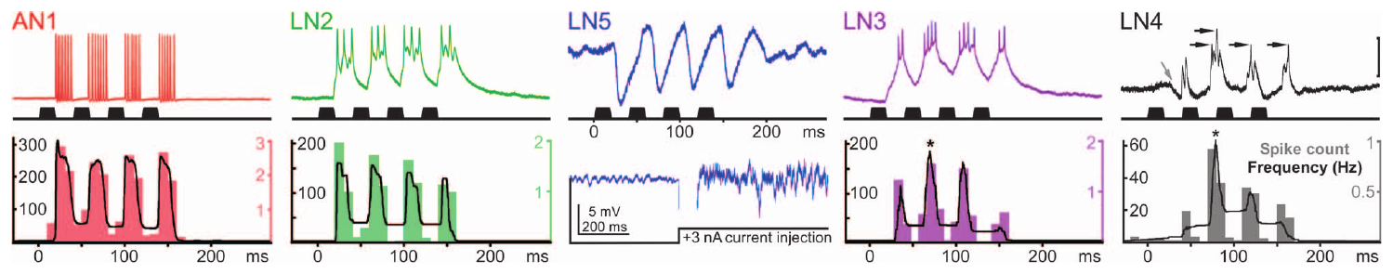
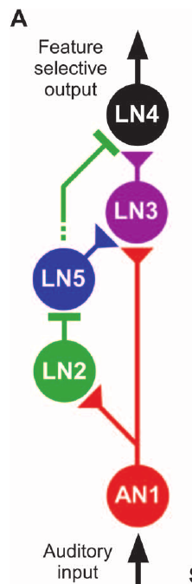
The second pulse recruits a different brain response
Schöneich and colleagues recorded the ascending neuron AN1 and four local brain cells during standard 4.8-kHz chirps. The chirps contained four 20-ms sound pulses separated by 20-ms silent intervals, providing repeated opportunities for interaction between successive responses.
AN1 and LN2 produced their strongest responses to the first pulse and adapted somewhat over the chirp. LN3 and LN4 responded most strongly to the second pulse; LN4 often failed to spike to the first despite receiving synaptic input.
The contrasting sequences support a transformation of sensory copying into timing-dependent output. A nonspiking neuron, LN5, changed membrane voltage without generating action potentials even during depolarizing current injection. Its graded response provides a distinct candidate mechanism for carrying temporally delayed information within the local brain circuit.
Schöneich et al. (2015), Fig. 2. Responses across the five-neuron auditory pathway.
Schöneich et al. (2015), Fig. 5(A). Proposed auditory circuit.
Schöneich et al. (2015)
24
Notes:
• Schöneich and colleagues recorded the ascending neuron AN1 and four local brain cells during standard 4.8-kHz chirps. The chirps contained four 20-ms sound pulses separated by 20-ms silent intervals, providing repeated opportunities for interaction between successive responses.
• AN1 and LN2 produced their strongest responses to the first pulse and adapted somewhat over the chirp. LN3 and LN4 responded most strongly to the second pulse; LN4 often failed to spike to the first despite receiving synaptic input.
• The contrasting sequences support a transformation of sensory copying into timing-dependent output. A **nonspiking neuron**, LN5, changed membrane voltage without generating action potentials even during depolarizing current injection. Its graded response provides a distinct candidate mechanism for carrying temporally delayed information within the local brain circuit.
• The recordings were obtained from different specimens and aligned to stimulus onset. Their plotted timing supports the proposed circuit, but the aligned traces are not simultaneous recordings of all five neurons.
References:
Schöneich S, Kostarakos K, Hedwig B (2015). An auditory feature detection circuit for sound pattern recognition. Science Advances 1(8):e1500325. https://doi.org/10.1126/sciadv.1500325
Figure: Schöneich et al. (2015), Fig. 2. Responses across the five-neuron auditory pathway.
Figure source: https://doi.org/10.1126/sciadv.1500325
Figure: Schöneich et al. (2015), Fig. 5(A). Proposed auditory circuit.
Figure source: https://doi.org/10.1126/sciadv.1500325

Slide 25
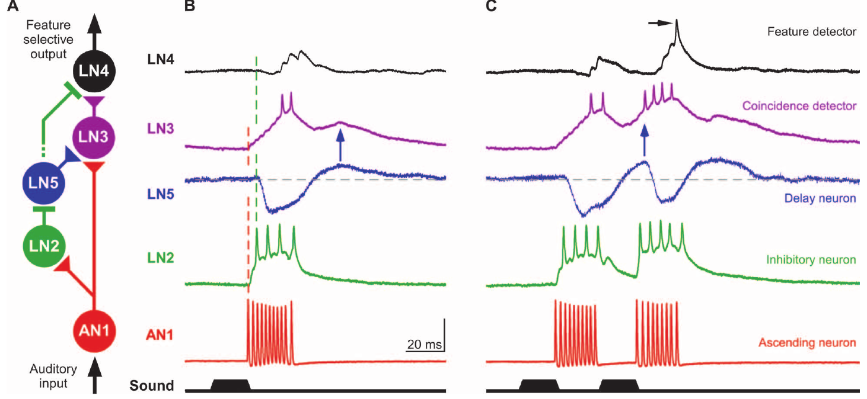
AN1 supplies fast excitation in the brain
In the proposed recognition circuit, AN1 supplies a direct excitatory pathway to local neurons LN2 and LN3. An EPSP is a depolarizing postsynaptic response; successive EPSPs can sum until a neuron crosses its spike threshold.
At 75 dB SPL, AN1’s brain response began about 20 ms after sound onset. LN2’s EPSPs began at approximately the same latency, and two large EPSPs were sufficient to trigger its spikes. LN3 required summation of roughly five or six smaller EPSPs.
Different integration requirements allow the same ascending pulse representation to produce different output timing. The inference of direct excitation rests on response latencies, frequency tuning and EPSP structure. Simultaneous paired intracellular recordings were not feasible, so each proposed connection should not be described as independently proven by a paired synaptic experiment.
Schöneich et al. (2015), Fig. 5(A–C). Proposed connections and measured response timing.
Schöneich et al. (2015)
25
Notes:
• In the proposed recognition circuit, AN1 supplies a direct excitatory pathway to local neurons LN2 and LN3. An **EPSP** is a depolarizing postsynaptic response; successive EPSPs can sum until a neuron crosses its spike threshold.
• At 75 dB SPL, AN1’s brain response began about 20 ms after sound onset. LN2’s EPSPs began at approximately the same latency, and two large EPSPs were sufficient to trigger its spikes. LN3 required summation of roughly five or six smaller EPSPs.
• Different integration requirements allow the same ascending pulse representation to produce different output timing. The inference of direct excitation rests on response latencies, frequency tuning and EPSP structure. Simultaneous paired intracellular recordings were not feasible, so each proposed connection should not be described as independently proven by a paired synaptic experiment.
• SPL means sound pressure level, referenced in these experiments to 20 μPa. The latency comparisons refer to a calibrated acoustic stimulus and do not imply that all cells have identical membrane properties.
References:
Schöneich S, Kostarakos K, Hedwig B (2015). An auditory feature detection circuit for sound pattern recognition. Science Advances 1(8):e1500325. https://doi.org/10.1126/sciadv.1500325
Figure: Schöneich et al. (2015), Fig. 5(A–C). Proposed connections and measured response timing.
Figure source: https://doi.org/10.1126/sciadv.1500325

Slide 26
LN2 provides a rapid inhibitory branch
LN2 is a local spiking brain interneuron whose activity closely follows the ascending acoustic input. Its response precedes inhibition in both the nonspiking delay neuron LN5 and the selective output neuron LN4 in the proposed network.
LN2 spiked approximately 23 ms after sound onset, while LN4 and LN5 began inhibitory responses near 25 ms. Above about 50 dB SPL, LN2 output was relatively insensitive to further increases in sound intensity, unlike AN1’s more intensity-dependent activity.
This timing and shared intensity dependence support LN2 as the inhibitory branch linking acoustic input to the two downstream cells. Inhibitory processing is established physiologically, but the study did not chemically identify its transmitter or receptor. Naming a particular GABA receptor would therefore exceed the evidence provided by these recordings.
Schöneich et al. (2015), Fig. 5(A–C). Proposed connections and measured response timing.
Schöneich et al. (2015)
26
Notes:
• **LN2** is a local spiking brain interneuron whose activity closely follows the ascending acoustic input. Its response precedes inhibition in both the nonspiking delay neuron LN5 and the selective output neuron LN4 in the proposed network.
• LN2 spiked approximately 23 ms after sound onset, while LN4 and LN5 began inhibitory responses near 25 ms. Above about 50 dB SPL, LN2 output was relatively insensitive to further increases in sound intensity, unlike AN1’s more intensity-dependent activity.
• This timing and shared intensity dependence support LN2 as the inhibitory branch linking acoustic input to the two downstream cells. Inhibitory processing is established physiologically, but the study did not chemically identify its transmitter or receptor. Naming a particular GABA receptor would therefore exceed the evidence provided by these recordings.
• A similar dependence on sound intensity can support a circuit relationship, but it is not equivalent to manipulating the presynaptic neuron while recording a unitary postsynaptic response. The network diagram is the authors’ evidence-based proposal.
References:
Schöneich S, Kostarakos K, Hedwig B (2015). An auditory feature detection circuit for sound pattern recognition. Science Advances 1(8):e1500325. https://doi.org/10.1126/sciadv.1500325
Figure: Schöneich et al. (2015), Fig. 5(A–C). Proposed connections and measured response timing.
Figure source: https://doi.org/10.1126/sciadv.1500325

Slide 27
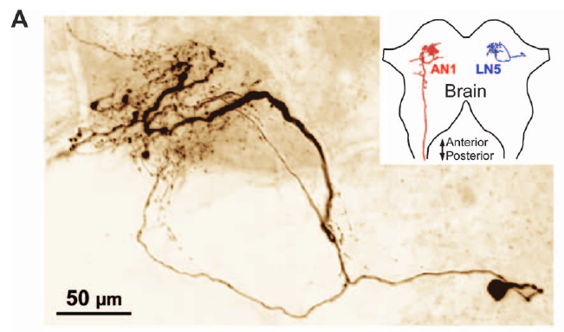
LN5 is an identified nonspiking delay-line neuron
LN5 has a ventrolateral cell body and branches near AN1’s terminals in the anterior protocerebrum. Its anatomical location places it within the local auditory network rather than in the thoracic sensory ganglion or a long ascending tract.
Schöneich and colleagues recorded sound-evoked hyperpolarization followed by depolarization in LN5. Standard 20-ms pulses produced inhibition of approximately 4–9 mV and a later depolarization of 3–5 mV above rest. Depolarizing current injection did not evoke spikes.
These properties distinguish a graded local signal from an axonal spike train. The delayed membrane depolarization can contribute excitation to later circuit processing, but morphology and voltage recording do not identify its transmitter. The published confocal image preserves the cell’s labeled arborization and 50-μm scale rather than reconstructing a new anatomical diagram.
Schöneich et al. (2015), Fig. 4(A). LN5 anatomy (50 μm).
Schöneich et al. (2015)
27
Notes:
• **LN5** has a ventrolateral cell body and branches near AN1’s terminals in the anterior protocerebrum. Its anatomical location places it within the local auditory network rather than in the thoracic sensory ganglion or a long ascending tract.
• Schöneich and colleagues recorded sound-evoked hyperpolarization followed by depolarization in LN5. Standard 20-ms pulses produced inhibition of approximately 4–9 mV and a later depolarization of 3–5 mV above rest. Depolarizing current injection did not evoke spikes.
• These properties distinguish a graded local signal from an axonal spike train. The delayed membrane depolarization can contribute excitation to later circuit processing, but morphology and voltage recording do not identify its transmitter. The published confocal image preserves the cell’s labeled arborization and 50-μm scale rather than reconstructing a new anatomical diagram.
• Hyperpolarization makes the recorded membrane voltage more negative, whereas depolarization makes it less negative. A nonspiking interneuron can communicate through graded membrane changes even though the study did not resolve the molecular mechanism of its output.
References:
Schöneich S, Kostarakos K, Hedwig B (2015). An auditory feature detection circuit for sound pattern recognition. Science Advances 1(8):e1500325. https://doi.org/10.1126/sciadv.1500325
Figure: Schöneich et al. (2015), Fig. 4(A). LN5 anatomy (50 μm).
Figure source: https://doi.org/10.1126/sciadv.1500325

Slide 28
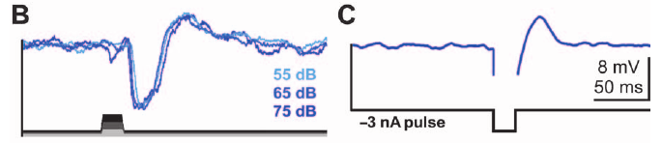
Release from inhibition generates rebound
Postinhibitory rebound is a depolarization occurring after inhibition ends. A delayed excitatory synaptic input could produce a superficially similar waveform, so Schöneich and colleagues tested whether LN5 could rebound when the auditory stimulus was replaced by injected current.
A 20-ms hyperpolarizing current pulse of −3 nA produced a 3–5-mV depolarization after release. Sound pulses at 55, 65 and 75 dB SPL also elicited similar rebound responses despite differences in stimulus intensity.
The current-injection control supports an intrinsic membrane contribution to the delayed signal rather than requiring delayed acoustic excitation alone. It does not identify the responsible conductance or prove that the rebound has a single molecular source. The cell’s voltage response establishes a physiological mechanism more directly than its transmitter or ion-channel identity.
Schöneich et al. (2015), Fig. 4(B–C). Sound and injected current evoke rebound.
Schöneich et al. (2015), Fig. 4(A). LN5 anatomy (50 μm).
Schöneich et al. (2015)
28
Notes:
• **Postinhibitory rebound** is a depolarization occurring after inhibition ends. A delayed excitatory synaptic input could produce a superficially similar waveform, so Schöneich and colleagues tested whether LN5 could rebound when the auditory stimulus was replaced by injected current.
• A 20-ms hyperpolarizing current pulse of −3 nA produced a 3–5-mV depolarization after release. Sound pulses at 55, 65 and 75 dB SPL also elicited similar rebound responses despite differences in stimulus intensity.
• The current-injection control supports an intrinsic membrane contribution to the delayed signal rather than requiring delayed acoustic excitation alone. It does not identify the responsible conductance or prove that the rebound has a single molecular source. The cell’s voltage response establishes a physiological mechanism more directly than its transmitter or ion-channel identity.
• Injecting current changes the recorded cell’s voltage without reproducing the entire auditory network input. Rebound after this manipulation separates a membrane property from a delay that would depend exclusively on another neuron’s late response.
References:
Schöneich S, Kostarakos K, Hedwig B (2015). An auditory feature detection circuit for sound pattern recognition. Science Advances 1(8):e1500325. https://doi.org/10.1126/sciadv.1500325
Figure: Schöneich et al. (2015), Fig. 4(B–C). Sound and injected current evoke rebound.
Figure source: https://doi.org/10.1126/sciadv.1500325
Figure: Schöneich et al. (2015), Fig. 4(A). LN5 anatomy (50 μm).
Figure source: https://doi.org/10.1126/sciadv.1500325

Slide 29
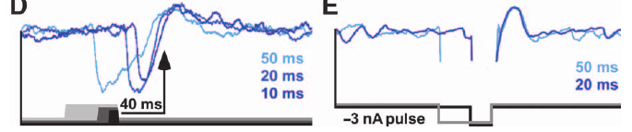
Rebound timing follows sound offset
A delay may be coupled to sound onset or to sound offset, and these alternatives predict different effects when pulse duration changes. LN5’s rebound was linked to release from hyperpolarization rather than to a fixed time after the initial acoustic event.
Schöneich and colleagues varied sound-pulse and current-pulse duration. Across the tested acoustic durations of 10–50 ms, the rebound peaked approximately 43 ms after sound offset. Current-evoked rebound likewise followed the end of the imposed hyperpolarization.
The delayed signal therefore marks the transition out of inhibition and can align with excitation produced by a following pulse. This is a cellular timing operation, not merely conduction through a longer axon. Its timing was measured under the experimental conditions; temperature or species differences were not systematically mapped in this experiment.
Schöneich et al. (2015), Fig. 4(D–E). Rebound follows release from inhibition.
Schöneich et al. (2015), Fig. 4(A). LN5 anatomy (50 μm).
Schöneich et al. (2015)
29
Notes:
• A delay may be coupled to sound onset or to sound offset, and these alternatives predict different effects when pulse duration changes. LN5’s rebound was linked to release from hyperpolarization rather than to a fixed time after the initial acoustic event.
• Schöneich and colleagues varied sound-pulse and current-pulse duration. Across the tested acoustic durations of 10–50 ms, the rebound peaked approximately 43 ms after sound offset. Current-evoked rebound likewise followed the end of the imposed hyperpolarization.
• The delayed signal therefore marks the transition out of inhibition and can align with excitation produced by a following pulse. This is a cellular timing operation, not merely conduction through a longer axon. Its timing was measured under the experimental conditions; temperature or species differences were not systematically mapped in this experiment.
• Changing pulse duration while aligning responses to offset tests the origin of the delay. The result distinguishes an offset-linked membrane process from an onset-linked timer that would peak at the same absolute delay for every pulse.
References:
Schöneich S, Kostarakos K, Hedwig B (2015). An auditory feature detection circuit for sound pattern recognition. Science Advances 1(8):e1500325. https://doi.org/10.1126/sciadv.1500325
Figure: Schöneich et al. (2015), Fig. 4(D–E). Rebound follows release from inhibition.
Figure source: https://doi.org/10.1126/sciadv.1500325
Figure: Schöneich et al. (2015), Fig. 4(A). LN5 anatomy (50 μm).
Figure source: https://doi.org/10.1126/sciadv.1500325

Slide 30
The rebound channel remains unidentified
A membrane conductance is the ease with which ions cross the neuronal membrane through channels. A hyperpolarization-activated channel opens more strongly at negative membrane voltages and could, in principle, contribute to depolarization during or after inhibition.
LN5’s 3–5-mV rebound after a −3-nA current pulse supports an intrinsic electrical mechanism. Schöneich and colleagues proposed that shared control of membrane proteins might couple timing in sender and receiver circuits, but did not pharmacologically isolate a channel in LN5.
The measured sequence is inhibition, release, rebound and delayed excitation. A specific channel subtype, transmitter or receptor cannot be inserted into that sequence as an established finding. The hypothesis links genetic matching to cellular timing plausibly, while the actual protein identity and its causal contribution to cricket song recognition remain unresolved by the study.
Schöneich et al. (2015), Fig. 4(B–C). Sound and injected current evoke rebound.
Schöneich et al. (2015), Fig. 4(A). LN5 anatomy (50 μm).
Schöneich et al. (2015)
30
Notes:
• A **membrane conductance** is the ease with which ions cross the neuronal membrane through channels. A **hyperpolarization-activated channel** opens more strongly at negative membrane voltages and could, in principle, contribute to depolarization during or after inhibition.
• LN5’s 3–5-mV rebound after a −3-nA current pulse supports an intrinsic electrical mechanism. Schöneich and colleagues proposed that shared control of membrane proteins might couple timing in sender and receiver circuits, but did not pharmacologically isolate a channel in LN5.
• The measured sequence is inhibition, release, rebound and delayed excitation. A specific channel subtype, transmitter or receptor cannot be inserted into that sequence as an established finding. The hypothesis links genetic matching to cellular timing plausibly, while the actual protein identity and its causal contribution to cricket song recognition remain unresolved by the study.
• Channel-based explanations are distinguished from recordings of the membrane phenomenon itself. The cited paper discusses hyperpolarization-activated channels as a plausible coupling mechanism, without reporting a blocker experiment or molecular identification in LN5.
References:
Schöneich S, Kostarakos K, Hedwig B (2015). An auditory feature detection circuit for sound pattern recognition. Science Advances 1(8):e1500325. https://doi.org/10.1126/sciadv.1500325
Figure: Schöneich et al. (2015), Fig. 4(B–C). Sound and injected current evoke rebound.
Figure source: https://doi.org/10.1126/sciadv.1500325
Figure: Schöneich et al. (2015), Fig. 4(A). LN5 anatomy (50 μm).
Figure source: https://doi.org/10.1126/sciadv.1500325

Slide 31
LN3 combines direct input with delayed excitation
A coincidence detector responds more strongly when separate inputs arrive together. In the proposed cricket circuit, LN3 receives rapid excitation associated with AN1 spikes and delayed excitation associated with LN5’s rebound after the previous sound pulse.
For two 20-ms pulses separated by a 20-ms silent interval, the direct response to the second pulse coincides with delayed depolarization following the first. LN3’s second-pulse spike response increases, and its spike latency falls from approximately 34 ms for the first pulse to 29 ms for the second.
The timing supports coincidence detection based on synaptic integration rather than an exact stored copy of the complete chirp. Direct and delayed pathways were inferred from their response properties, not all established by simultaneous recordings. LN3’s enhanced response supplies a mechanism for temporal selectivity but does not itself specify the entire motor output.
Schöneich et al. (2015), Fig. 5(A–C). Proposed connections and measured response timing.
Schöneich et al. (2015)
31
Notes:
• A **coincidence detector** responds more strongly when separate inputs arrive together. In the proposed cricket circuit, LN3 receives rapid excitation associated with AN1 spikes and delayed excitation associated with LN5’s rebound after the previous sound pulse.
• For two 20-ms pulses separated by a 20-ms silent interval, the direct response to the second pulse coincides with delayed depolarization following the first. LN3’s second-pulse spike response increases, and its spike latency falls from approximately 34 ms for the first pulse to 29 ms for the second.
• The timing supports coincidence detection based on synaptic integration rather than an exact stored copy of the complete chirp. Direct and delayed pathways were inferred from their response properties, not all established by simultaneous recordings. LN3’s enhanced response supplies a mechanism for temporal selectivity but does not itself specify the entire motor output.
• The first pulse establishes a delayed state that changes the response to the next. Rebound timing, ascending spike timing and LN3 membrane integration all contribute to coincidence; no newly drawn delay-line model is needed to interpret the published recordings.
References:
Schöneich S, Kostarakos K, Hedwig B (2015). An auditory feature detection circuit for sound pattern recognition. Science Advances 1(8):e1500325. https://doi.org/10.1126/sciadv.1500325
Figure: Schöneich et al. (2015), Fig. 5(A–C). Proposed connections and measured response timing.
Figure source: https://doi.org/10.1126/sciadv.1500325

Slide 32
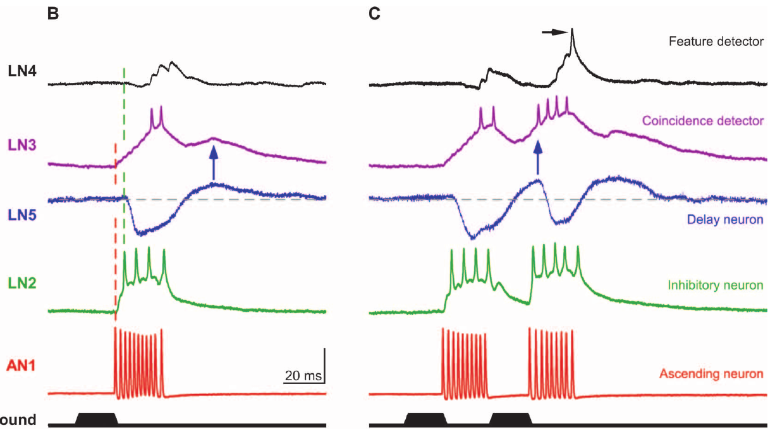
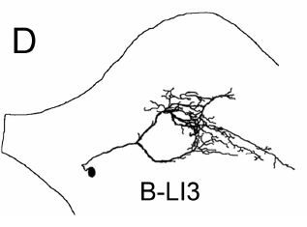
LN3 favors an intermediate interval between pulses
Schöneich and colleagues tested LN3 with pairs of 20-ms pulses separated by different silent intervals. A long interval allows the first delayed response to finish before the second direct response, whereas a very short interval merges or truncates the two responses.
At a 60-ms interval, LN3 generated similar responses to the two pulses. At 20 ms, its output increased from approximately 1.6 spikes to 3.2 spikes for the second pulse. The strongest enhancement occurred over intervals of about 15–25 ms.
This intermediate optimum is consistent with direct and delayed excitation summing during an appropriate temporal window. The cell also responds outside that window, so it is less selective than the final output neuron. Its tuning should not be equated with a complete behavioral acceptance decision or an absolute inability to detect other sounds.
Schöneich et al. (2015), Fig. 5(B–C). Responses to one and two pulses.
Kostarakos & Hedwig (2012), Fig. 1(D). LN3 (200 μm common scale).
Schöneich et al. (2015); Kostarakos & Hedwig (2012)
32
Notes:
• Schöneich and colleagues tested LN3 with pairs of 20-ms pulses separated by different silent intervals. A long interval allows the first delayed response to finish before the second direct response, whereas a very short interval merges or truncates the two responses.
• At a 60-ms interval, LN3 generated similar responses to the two pulses. At 20 ms, its output increased from approximately 1.6 spikes to 3.2 spikes for the second pulse. The strongest enhancement occurred over intervals of about 15–25 ms.
• This intermediate optimum is consistent with direct and delayed excitation summing during an appropriate temporal window. The cell also responds outside that window, so it is less selective than the final output neuron. Its tuning should not be equated with a complete behavioral acceptance decision or an absolute inability to detect other sounds.
• The delayed component peaks approximately 43.5 ms after sound offset. The timing of excitation arriving from the next pulse determines whether that component overlaps sufficiently with the direct pathway to enhance firing.
References:
Schöneich S, Kostarakos K, Hedwig B (2015). An auditory feature detection circuit for sound pattern recognition. Science Advances 1(8):e1500325. https://doi.org/10.1126/sciadv.1500325
Kostarakos K, Hedwig B (2012). Calling song recognition in female crickets: temporal tuning of identified brain neurons matches behavior. Journal of Neuroscience 32(28):9601–9612. https://doi.org/10.1523/JNEUROSCI.1170-12.2012
Figure: Schöneich et al. (2015), Fig. 5(B–C). Responses to one and two pulses.
Figure source: https://doi.org/10.1126/sciadv.1500325
Figure: Kostarakos & Hedwig (2012), Fig. 1(D). LN3 (200 μm common scale).
Figure source: https://doi.org/10.1523/JNEUROSCI.1170-12.2012

Slide 33
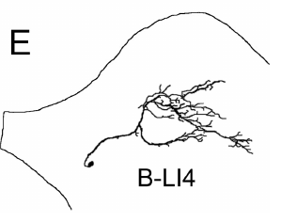
LN4 integrates excitation and inhibition
A feature detector responds preferentially to a stimulus property associated with a meaningful signal. LN4 combines the inhibitory branch attributed to LN2 with excitation following LN3’s coincidence-enhanced activity in the proposed song-recognition circuit.
A single 20-ms pulse usually produced inhibition followed by subthreshold depolarization in LN4. A second pulse after a 20-ms interval evoked approximately 1.4 spikes. Excitatory responses in LN4 followed LN3 spikes with a relatively constant delay near 3 ms.
The second-pulse excitation can overcome inhibition when the interval is appropriate, creating a more selective output than LN3 alone. LN4 is not the primary coincidence detector because it does not receive the delayed excitatory component directly. These relationships support the proposed sequence but do not identify the transmitter or prove that LN4 alone is necessary for approach.
Schöneich et al. (2015), Fig. 5(B–C). Responses to one and two pulses.
Kostarakos & Hedwig (2012), Fig. 1(E). LN4 (200 μm common scale).
Schöneich et al. (2015); Kostarakos & Hedwig (2012)
33
Notes:
• A **feature detector** responds preferentially to a stimulus property associated with a meaningful signal. LN4 combines the inhibitory branch attributed to LN2 with excitation following LN3’s coincidence-enhanced activity in the proposed song-recognition circuit.
• A single 20-ms pulse usually produced inhibition followed by subthreshold depolarization in LN4. A second pulse after a 20-ms interval evoked approximately 1.4 spikes. Excitatory responses in LN4 followed LN3 spikes with a relatively constant delay near 3 ms.
• The second-pulse excitation can overcome inhibition when the interval is appropriate, creating a more selective output than LN3 alone. LN4 is not the primary coincidence detector because it does not receive the delayed excitatory component directly. These relationships support the proposed sequence but do not identify the transmitter or prove that LN4 alone is necessary for approach.
• Subthreshold input changes the membrane voltage without eliciting a spike. Combining inhibition with strengthened excitation can sharpen selectivity even when the preceding neuron retains responses to less attractive patterns.
References:
Schöneich S, Kostarakos K, Hedwig B (2015). An auditory feature detection circuit for sound pattern recognition. Science Advances 1(8):e1500325. https://doi.org/10.1126/sciadv.1500325
Kostarakos K, Hedwig B (2012). Calling song recognition in female crickets: temporal tuning of identified brain neurons matches behavior. Journal of Neuroscience 32(28):9601–9612. https://doi.org/10.1523/JNEUROSCI.1170-12.2012
Figure: Schöneich et al. (2015), Fig. 5(B–C). Responses to one and two pulses.
Figure source: https://doi.org/10.1126/sciadv.1500325
Figure: Kostarakos & Hedwig (2012), Fig. 1(E). LN4 (200 μm common scale).
Figure source: https://doi.org/10.1523/JNEUROSCI.1170-12.2012

Slide 34
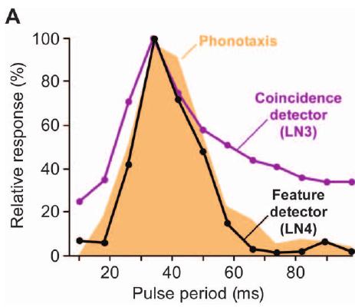
LN4 tuning matches phonotactic preference
Schöneich and colleagues compared neuronal pulse-period tuning with female phonotaxis using constant-sound-energy chirps. Band-pass selectivity favors intermediate periods and rejects both rapidly repeated and widely separated pulses rather than merely increasing with sound duration.
Across pulse periods of 10–98 ms, behavioral attraction peaked around 34 ms. LN3 and LN4 had similar optima, but the stronger filtering in LN4 more closely matched the behavioral response. The original figure plots these separately measured curves together.
The match links a physiological mechanism to the animal’s accepted timing range while avoiding a simple sound-energy explanation. It remains evidence of correspondence rather than a cell-specific behavioral intervention. Connections from the local feature detector to descending motor pathways and the necessity of that detector were not established by the tuning comparison.
Schöneich et al. (2015), Fig. 6(A). Neural and behavioral pulse-period tuning.
Schöneich et al. (2015), Fig. 5(A). Proposed auditory circuit.
Schöneich et al. (2015)
34
Notes:
• Schöneich and colleagues compared neuronal pulse-period tuning with female phonotaxis using constant-sound-energy chirps. **Band-pass selectivity** favors intermediate periods and rejects both rapidly repeated and widely separated pulses rather than merely increasing with sound duration.
• Across pulse periods of 10–98 ms, behavioral attraction peaked around 34 ms. LN3 and LN4 had similar optima, but the stronger filtering in LN4 more closely matched the behavioral response. The original figure plots these separately measured curves together.
• The match links a physiological mechanism to the animal’s accepted timing range while avoiding a simple sound-energy explanation. It remains evidence of correspondence rather than a cell-specific behavioral intervention. Connections from the local feature detector to descending motor pathways and the necessity of that detector were not established by the tuning comparison.
• Neural tuning and phonotaxis were measured independently. A common optimum strengthens a recognition interpretation but cannot, by itself, determine whether another unrecorded pathway contributes to the same preference.
References:
Schöneich S, Kostarakos K, Hedwig B (2015). An auditory feature detection circuit for sound pattern recognition. Science Advances 1(8):e1500325. https://doi.org/10.1126/sciadv.1500325
Figure: Schöneich et al. (2015), Fig. 6(A). Neural and behavioral pulse-period tuning.
Figure source: https://doi.org/10.1126/sciadv.1500325
Figure: Schöneich et al. (2015), Fig. 5(A). Proposed auditory circuit.
Figure source: https://doi.org/10.1126/sciadv.1500325

Slide 35
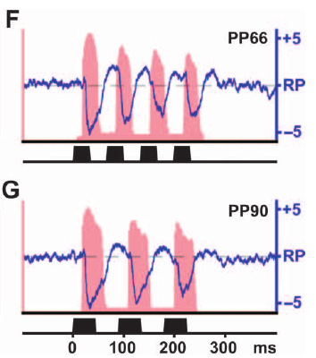
Slow pulses separate the two excitatory pathways
At slow pulse repetition, the delayed response to one event and the direct response to the next occur at different times. They therefore contribute less simultaneous excitation to LN3 even though AN1 can still report the individual sound pulses.
For pulse periods of 66–98 ms, Schöneich and colleagues found that AN1 spike activity and LN5 rebound depolarization drifted out of phase. These values corresponded to silent intervals of 33–49 ms in the tested constant-energy patterns.
Loss of overlap explains the circuit’s reduced response to slow patterns without requiring failure of auditory detection. It establishes the slow-period side of the band-pass mechanism. The interpretation depends on measured timing in the direct and delayed pathways and should not be generalized to all cricket species with different natural song periods.
Schöneich et al. (2015), Fig. 6(F–G). Slow pulses separate direct and delayed activity.
Schöneich et al. (2015), Fig. 5(A). Proposed auditory circuit.
Schöneich et al. (2015)
35
Notes:
• At slow pulse repetition, the delayed response to one event and the direct response to the next occur at different times. They therefore contribute less simultaneous excitation to LN3 even though AN1 can still report the individual sound pulses.
• For pulse periods of 66–98 ms, Schöneich and colleagues found that AN1 spike activity and LN5 rebound depolarization drifted out of phase. These values corresponded to silent intervals of 33–49 ms in the tested constant-energy patterns.
• Loss of overlap explains the circuit’s reduced response to slow patterns without requiring failure of auditory detection. It establishes the slow-period side of the band-pass mechanism. The interpretation depends on measured timing in the direct and delayed pathways and should not be generalized to all cricket species with different natural song periods.
• The published red AN1 activity and blue LN5 membrane traces retain the source’s time axes and voltage units. Separation of their peaks is a physiological observation, rather than a newly plotted theoretical curve.
References:
Schöneich S, Kostarakos K, Hedwig B (2015). An auditory feature detection circuit for sound pattern recognition. Science Advances 1(8):e1500325. https://doi.org/10.1126/sciadv.1500325
Figure: Schöneich et al. (2015), Fig. 6(F–G). Slow pulses separate direct and delayed activity.
Figure source: https://doi.org/10.1126/sciadv.1500325
Figure: Schöneich et al. (2015), Fig. 5(A). Proposed auditory circuit.
Figure source: https://doi.org/10.1126/sciadv.1500325

Slide 36
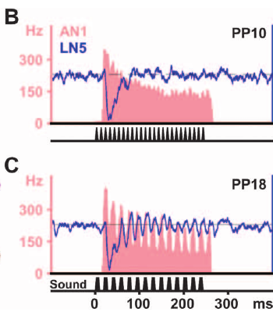
Fast pulses truncate rebound and weaken the input
Rapid repetition does not automatically create stronger coincidence. A new pulse can recruit inhibition before the previous LN5 rebound has developed, while adaptation reduces the fidelity and strength of the ascending acoustic response.
Schöneich and colleagues tested pulse periods below 34 ms, corresponding to intervals shorter than 17 ms. LN5 rebound was increasingly truncated by following inhibition, and AN1 adapted strongly enough to lose accurate copying of the fastest tested pulse patterns.
These effects weaken both the delayed and direct contributions to LN3 and establish the fast-period side of band-pass tuning. A delay line alone would predict responses to some faster repetitions; the measured membrane and adaptation processes constrain that simpler account. Their relative necessity was not separated by selectively eliminating each process during behavior.
Schöneich et al. (2015), Fig. 6(B–C). Fast pulses truncate rebound.
Schöneich et al. (2015), Fig. 5(A). Proposed auditory circuit.
Schöneich et al. (2015)
36
Notes:
• Rapid repetition does not automatically create stronger coincidence. A new pulse can recruit inhibition before the previous LN5 rebound has developed, while adaptation reduces the fidelity and strength of the ascending acoustic response.
• Schöneich and colleagues tested pulse periods below 34 ms, corresponding to intervals shorter than 17 ms. LN5 rebound was increasingly truncated by following inhibition, and AN1 adapted strongly enough to lose accurate copying of the fastest tested pulse patterns.
• These effects weaken both the delayed and direct contributions to LN3 and establish the fast-period side of band-pass tuning. A delay line alone would predict responses to some faster repetitions; the measured membrane and adaptation processes constrain that simpler account. Their relative necessity was not separated by selectively eliminating each process during behavior.
• Adaptation is a decline in responsiveness during repeated stimulation. In this circuit, adaptation and renewed inhibition jointly restrict fast-pattern responses, rather than making recognition depend on a coincidence detector with an unrestricted fixed delay.
References:
Schöneich S, Kostarakos K, Hedwig B (2015). An auditory feature detection circuit for sound pattern recognition. Science Advances 1(8):e1500325. https://doi.org/10.1126/sciadv.1500325
Figure: Schöneich et al. (2015), Fig. 6(B–C). Fast pulses truncate rebound.
Figure source: https://doi.org/10.1126/sciadv.1500325
Figure: Schöneich et al. (2015), Fig. 5(A). Proposed auditory circuit.
Figure source: https://doi.org/10.1126/sciadv.1500325

Slide 37
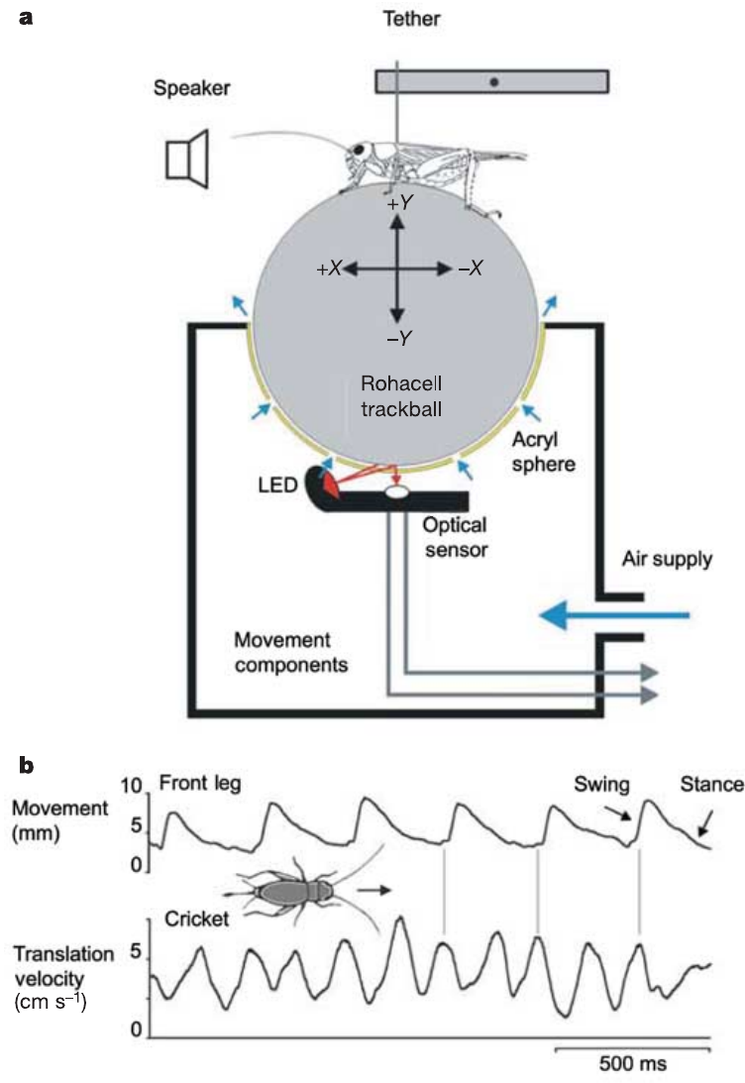
A fast trackball resolves pulse-linked steering
Hedwig and Poulet measured female Gryllus bimaculatus walking on a lightweight trackball floating in air. An optical sensor registered small ball movements, allowing lateral steering to be measured separately from forward walking rather than averaged over a whole chirp.
The system had a temporal resolution of 0.3 ms. During acoustic approach, females walked at approximately 5–7 cm/s, and their lateral velocity could change rapidly in response to individual pulses. Slow trackball measurements had previously averaged over much longer time windows.
The preparation reveals motor responses that a coarse measure can merge into an apparently smooth trajectory. High temporal resolution does not create a new recognition behavior; it changes which components of the existing behavior are observable. Tethering and the absence of actual translation still limit direct extrapolation to free-field approach paths.
Hedwig & Poulet (2004), Fig. 1(a–b). Cricket trackball and resolved stepping.
Hedwig & Poulet (2004)
37
Notes:
• Hedwig and Poulet measured female _Gryllus bimaculatus_ walking on a lightweight trackball floating in air. An optical sensor registered small ball movements, allowing lateral steering to be measured separately from forward walking rather than averaged over a whole chirp.
• The system had a temporal resolution of 0.3 ms. During acoustic approach, females walked at approximately 5–7 cm/s, and their lateral velocity could change rapidly in response to individual pulses. Slow trackball measurements had previously averaged over much longer time windows.
• The preparation reveals motor responses that a coarse measure can merge into an apparently smooth trajectory. High temporal resolution does not create a new recognition behavior; it changes which components of the existing behavior are observable. Tethering and the absence of actual translation still limit direct extrapolation to free-field approach paths.
• The published trackball illustration includes the animal and optical measurement arrangement. Forward and lateral velocity are distinct components of motion, so a cricket can continue walking forward while making alternating steering corrections.
References:
Hedwig B, Poulet JFA (2004). Complex auditory behaviour emerges from simple reactive steering. Nature 430(7001):781–785. https://doi.org/10.1038/nature02787
Figure: Hedwig & Poulet (2004), Fig. 1(a–b). Cricket trackball and resolved stepping.
Figure source: https://doi.org/10.1038/nature02787

Slide 38
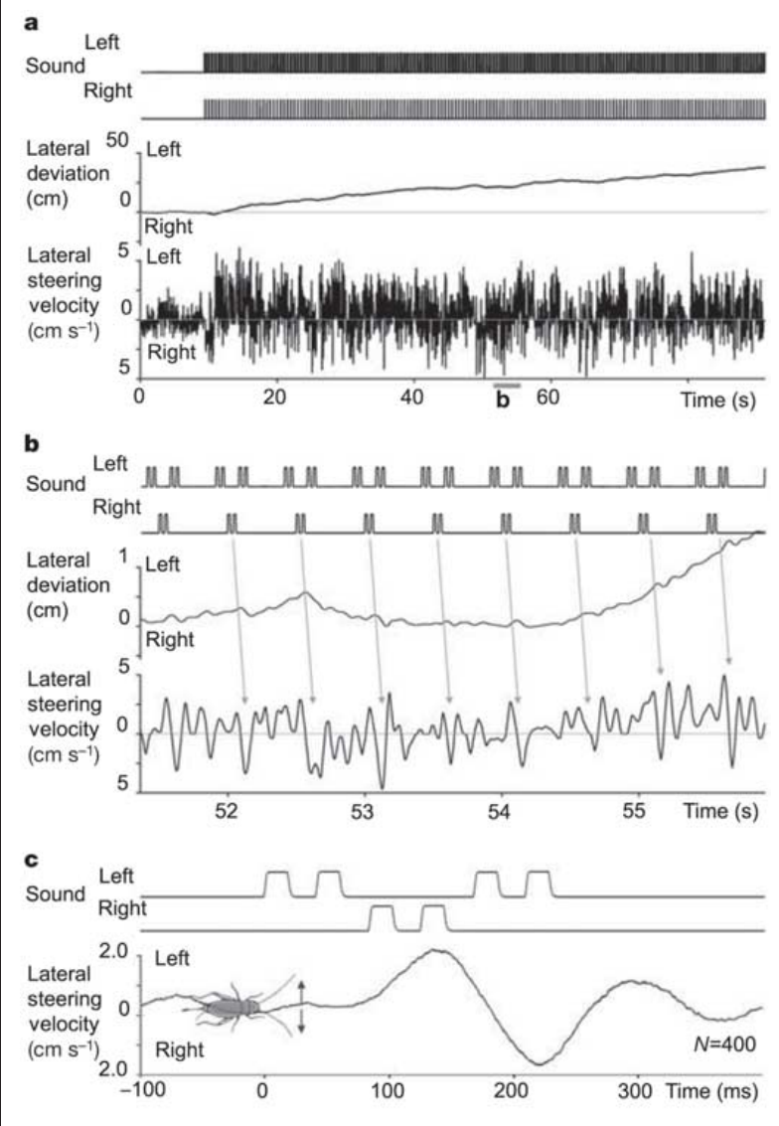
Split songs elicit rapid steering corrections
A split song distributes successive parts of one chirp across two speakers. Hedwig and Poulet presented six-pulse chirps in which pairs of consecutive pulses came from opposite sides, each speaker positioned 45° from the cricket’s forward axis.
Pulses lasted 21 ms and were separated by 21-ms intervals. Lateral steering followed the active side with a latency of approximately 55–60 ms and peak velocity near 5 cm/s. Each pulse pair produced a small lateral displacement of about 1 mm.
The animal’s overall path favored the side presenting more pulses, yet its individual corrections followed both sides. Net deviation therefore conceals alternating stimulus-linked responses. This result challenges a purely whole-chirp account of immediate steering, but does not imply that temporal pattern recognition is absent from longer-term responsiveness.
Hedwig & Poulet (2004), Fig. 2(a–c). Rapid steering toward split-song pulses.
Hedwig & Poulet (2004)
38
Notes:
• A **split song** distributes successive parts of one chirp across two speakers. Hedwig and Poulet presented six-pulse chirps in which pairs of consecutive pulses came from opposite sides, each speaker positioned 45° from the cricket’s forward axis.
• Pulses lasted 21 ms and were separated by 21-ms intervals. Lateral steering followed the active side with a latency of approximately 55–60 ms and peak velocity near 5 cm/s. Each pulse pair produced a small lateral displacement of about 1 mm.
• The animal’s overall path favored the side presenting more pulses, yet its individual corrections followed both sides. Net deviation therefore conceals alternating stimulus-linked responses. This result challenges a purely whole-chirp account of immediate steering, but does not imply that temporal pattern recognition is absent from longer-term responsiveness.
• A cumulative path and an instantaneous velocity trace answer different questions. The former measures the integrated outcome, whereas the latter exposes the sequence of corrections contributing to that outcome.
References:
Hedwig B, Poulet JFA (2004). Complex auditory behaviour emerges from simple reactive steering. Nature 430(7001):781–785. https://doi.org/10.1038/nature02787
Figure: Hedwig & Poulet (2004), Fig. 2(a–c). Rapid steering toward split-song pulses.
Figure source: https://doi.org/10.1038/nature02787

Slide 39
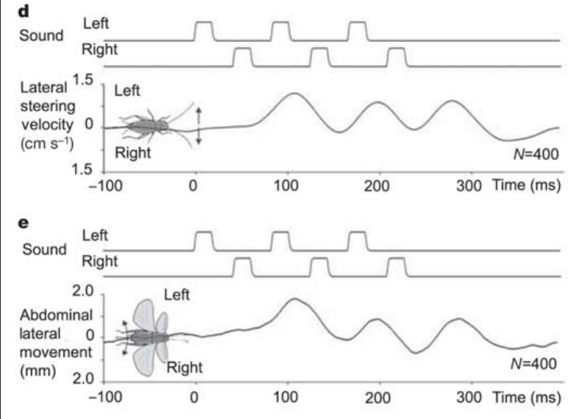
Walking and flight retain pulse-linked steering
Auditory orientation can be expressed through different motor systems. During walking, cricket leg movements produce lateral trajectory changes; during tethered flight, abdominal movement serves as a measurable steering response toward a sound source.
Hedwig and Poulet tested the same females with consecutive pulses alternating between speakers. A constant wind stream elicited flight, and an optical recording system measured abdominal displacement. Flight steering followed the alternating sound pulses with a temporal pattern comparable to walking steering.
The correspondence supports rapid acoustic steering across locomotor modes rather than a response unique to one trackball mechanism. It does not establish identical descending circuitry or muscles in walking and flight. Similar behavioral dynamics can result from shared sensory processing that reaches different state-dependent motor pathways.
Hedwig & Poulet (2004), Fig. 2(d–e). Pulse-linked steering during walking and flight.
Hedwig & Poulet (2004)
39
Notes:
• Auditory orientation can be expressed through different motor systems. During walking, cricket leg movements produce lateral trajectory changes; during tethered flight, abdominal movement serves as a measurable steering response toward a sound source.
• Hedwig and Poulet tested the same females with consecutive pulses alternating between speakers. A constant wind stream elicited flight, and an optical recording system measured abdominal displacement. Flight steering followed the alternating sound pulses with a temporal pattern comparable to walking steering.
• The correspondence supports rapid acoustic steering across locomotor modes rather than a response unique to one trackball mechanism. It does not establish identical descending circuitry or muscles in walking and flight. Similar behavioral dynamics can result from shared sensory processing that reaches different state-dependent motor pathways.
• The measured flight variable is abdominal steering, not an actual airborne trajectory. Comparing its time course with trackball lateral velocity supports a common rapid sensory influence while retaining the distinction between the motor measurements.
References:
Hedwig B, Poulet JFA (2004). Complex auditory behaviour emerges from simple reactive steering. Nature 430(7001):781–785. https://doi.org/10.1038/nature02787
Figure: Hedwig & Poulet (2004), Fig. 2(d–e). Pulse-linked steering during walking and flight.
Figure source: https://doi.org/10.1038/nature02787

Slide 40
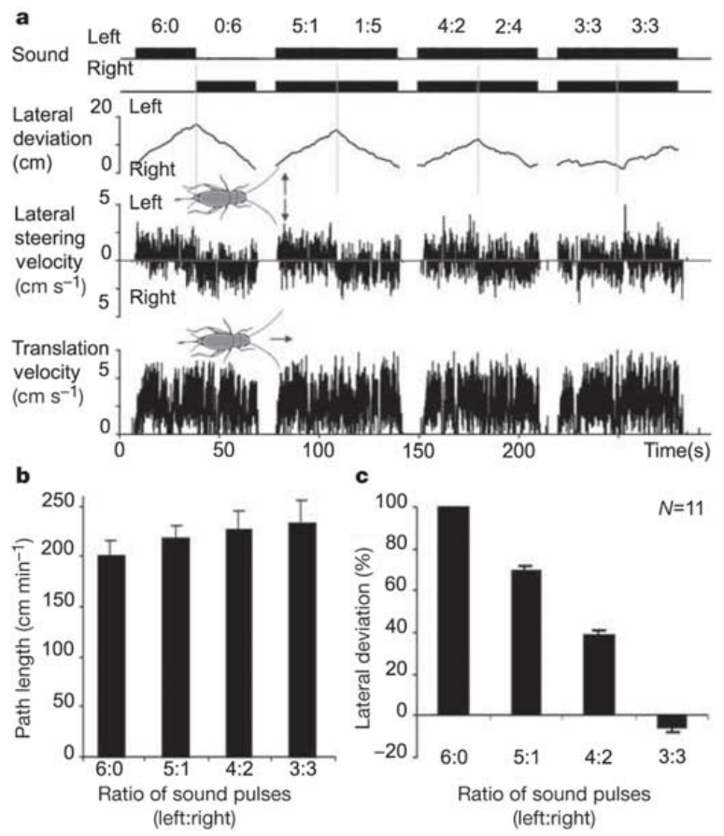
Pulse ratios predict net lateral deviation
When a chirp is divided between competing directions, net steering can accumulate from corrections toward individual pulses. Hedwig and Poulet varied how many of six pulses arrived from each side rather than changing the total number presented.
Females generally deviated toward the speaker providing the larger share, across ratios including 5:1, 4:2 and 3:3. At equal pulse numbers, opposing steering contributions reduced net lateral deviation even though acoustic stimulation and forward walking continued.
The result supports accumulation of rapid directional responses as an explanation for overall orientation under these split-song conditions. It does not mean the nervous system literally counts pulses with a dedicated arithmetic neuron. The measured path can emerge from unequal motor corrections without an explicit complete-chirp choice preceding every movement.
Hedwig & Poulet (2004), Fig. 3(a–c). Pulse ratios predict net lateral deviation.
Hedwig & Poulet (2004)
40
Notes:
• When a chirp is divided between competing directions, net steering can accumulate from corrections toward individual pulses. Hedwig and Poulet varied how many of six pulses arrived from each side rather than changing the total number presented.
• Females generally deviated toward the speaker providing the larger share, across ratios including 5:1, 4:2 and 3:3. At equal pulse numbers, opposing steering contributions reduced net lateral deviation even though acoustic stimulation and forward walking continued.
• The result supports accumulation of rapid directional responses as an explanation for overall orientation under these split-song conditions. It does not mean the nervous system literally counts pulses with a dedicated arithmetic neuron. The measured path can emerge from unequal motor corrections without an explicit complete-chirp choice preceding every movement.
• Maintaining six pulses controls total pulse number while changing their spatial assignment. Randomizing which pulses came from each side reduces the likelihood that one fixed position in the chirp alone explains the net direction.
References:
Hedwig B, Poulet JFA (2004). Complex auditory behaviour emerges from simple reactive steering. Nature 430(7001):781–785. https://doi.org/10.1038/nature02787
Figure: Hedwig & Poulet (2004), Fig. 3(a–c). Pulse ratios predict net lateral deviation.
Figure source: https://doi.org/10.1038/nature02787

Slide 41
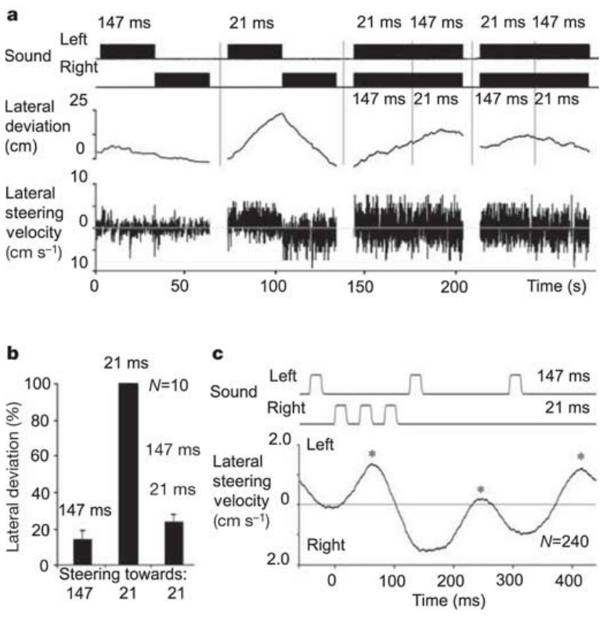
Recognition modulates reactive steering
Recognition of an attractive rhythm and rapid localization of its pulses are separable processes. Hedwig and Poulet compared three-pulse patterns with 21-ms or 147-ms intervals and also presented the two patterns simultaneously from opposite sides.
The 147-ms pattern alone produced approximately 14% of the reference steering response. The 21-ms pattern was strongly attractive alone, but its net response fell to about 24% when the competing pattern was also present; the animal made corrections toward pulses from both directions.
A weakly attractive temporal pattern can therefore influence immediate steering during concurrent attractive stimulation. The authors proposed modulation of a rapid reactive pathway over a longer time course. The behavior does not identify the cellular modulation mechanism or invalidate selective brain responses measured with other temporal paradigms.
Hedwig & Poulet (2004), Fig. 4(a–c). Competing temporal patterns redirect steering.
Hedwig & Poulet (2004)
41
Notes:
• Recognition of an attractive rhythm and rapid localization of its pulses are separable processes. Hedwig and Poulet compared three-pulse patterns with 21-ms or 147-ms intervals and also presented the two patterns simultaneously from opposite sides.
• The 147-ms pattern alone produced approximately 14% of the reference steering response. The 21-ms pattern was strongly attractive alone, but its net response fell to about 24% when the competing pattern was also present; the animal made corrections toward pulses from both directions.
• A weakly attractive temporal pattern can therefore influence immediate steering during concurrent attractive stimulation. The authors proposed modulation of a rapid reactive pathway over a longer time course. The behavior does not identify the cellular modulation mechanism or invalidate selective brain responses measured with other temporal paradigms.
• The experiment distinguishes attractiveness when a pattern is presented alone from its ability to redirect movement during concurrent song. Context changes how recognition and directional motor responses combine, without proving that the cricket confuses the two rhythms.
References:
Hedwig B, Poulet JFA (2004). Complex auditory behaviour emerges from simple reactive steering. Nature 430(7001):781–785. https://doi.org/10.1038/nature02787
Figure: Hedwig & Poulet (2004), Fig. 4(a–c). Competing temporal patterns redirect steering.
Figure source: https://doi.org/10.1038/nature02787

Slide 42
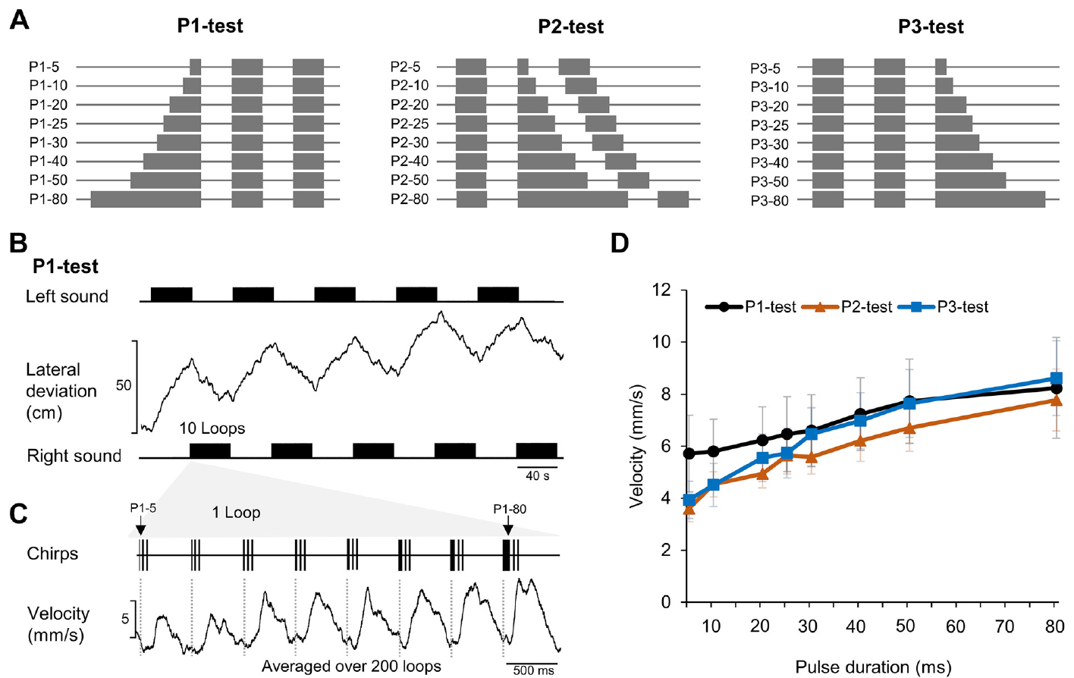
Duration tests challenge the canonical circuit
Zhang and Hedwig varied one pulse within a three-pulse chirp while recording phonotaxis and identified brain neurons in female Gryllus bimaculatus. This tests timing sensitivity beyond simply changing every pulse and pause together.
The selected first, second or third pulse ranged from 5 to 80 ms. Other pulses and silent intervals remained 20 ms; chirps repeated every 500 ms with a 4.8-kHz carrier. Alternating left and right presentation reduced persistent directional bias.
Phonotactic steering increased with longer test pulses more broadly than expected from the selective output of the canonical recognition circuit. Because these test patterns were embedded in loops containing attractive chirps, the behavior concerns that stimulation context. It does not establish that isolated long-pulse songs are generally preferred or that previous period-selectivity results were incorrect.
Zhang & Hedwig (2023), Fig. 1(A–D). Pulse-duration tests and phonotactic responses.
Zhang & Hedwig (2023)
42
Notes:
• Zhang and Hedwig varied one pulse within a three-pulse chirp while recording phonotaxis and identified brain neurons in female _Gryllus bimaculatus_. This tests timing sensitivity beyond simply changing every pulse and pause together.
• The selected first, second or third pulse ranged from 5 to 80 ms. Other pulses and silent intervals remained 20 ms; chirps repeated every 500 ms with a 4.8-kHz carrier. Alternating left and right presentation reduced persistent directional bias.
• Phonotactic steering increased with longer test pulses more broadly than expected from the selective output of the canonical recognition circuit. Because these test patterns were embedded in loops containing attractive chirps, the behavior concerns that stimulation context. It does not establish that isolated long-pulse songs are generally preferred or that previous period-selectivity results were incorrect.
• Keeping two pulses normal preserves attractive temporal elements within the stimulus sequence. The new test therefore interrogates processing under a mixed temporal context rather than simply repeating a uniform pulse-period tuning experiment.
References:
Zhang X, Hedwig B (2023). Sound processing in the cricket brain: evidence for a pulse duration filter. Journal of Neurophysiology 130:953–966. https://doi.org/10.1152/jn.00252.2023
Figure: Zhang & Hedwig (2023), Fig. 1(A–D). Pulse-duration tests and phonotactic responses.
Figure source: https://doi.org/10.1152/jn.00252.2023

Slide 43
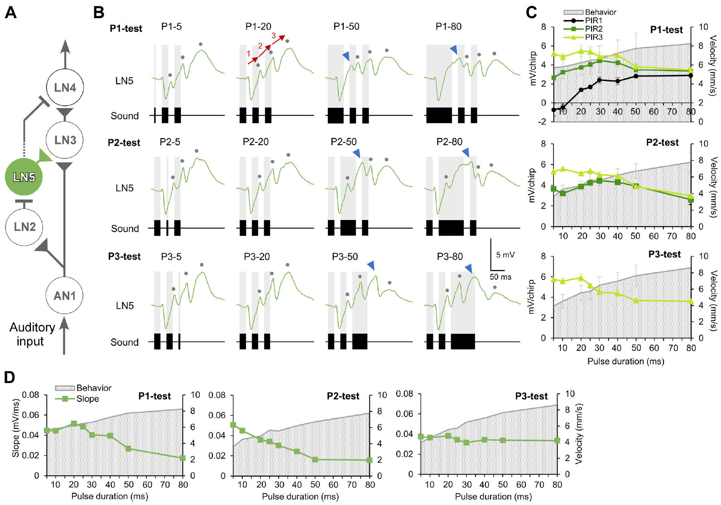
LN5 rebound depends on duration and position
Zhang and Hedwig recorded LN5 during the three pulse-position tests. The cell remained nonspiking and exhibited alternating inhibitory responses and rebound depolarizations, but the individual rebounds were not interchangeable across positions in the chirp.
Extending the first pulse from 5 toward 80 ms increased its subsequent rebound, and pulses longer than about 30 ms could produce an additional deflection before the main rebound. Comparable extensions at other pulse positions did not yield identical changes.
These responses complicate a simple fixed-delay account in which every pulse generates the same delayed signal. Intrinsic and network-dependent membrane dynamics interact with preceding sound history. The new recordings do not molecularly identify the conductance responsible, nor do they establish that LN5 alone explains the broad behavioral response to long pulses.
Zhang & Hedwig (2023), Fig. 3(A–D). LN5 rebound during varied pulse durations.
Zhang & Hedwig (2023)
43
Notes:
• Zhang and Hedwig recorded LN5 during the three pulse-position tests. The cell remained nonspiking and exhibited alternating inhibitory responses and rebound depolarizations, but the individual rebounds were not interchangeable across positions in the chirp.
• Extending the first pulse from 5 toward 80 ms increased its subsequent rebound, and pulses longer than about 30 ms could produce an additional deflection before the main rebound. Comparable extensions at other pulse positions did not yield identical changes.
• These responses complicate a simple fixed-delay account in which every pulse generates the same delayed signal. Intrinsic and network-dependent membrane dynamics interact with preceding sound history. The new recordings do not molecularly identify the conductance responsible, nor do they establish that LN5 alone explains the broad behavioral response to long pulses.
• The original diagram identifies LN5 within the proposed circuit, and the recordings retain separate first, second and third rebound labels. Pulse position controls which previous inhibitory and excitatory states the tested event encounters.
References:
Zhang X, Hedwig B (2023). Sound processing in the cricket brain: evidence for a pulse duration filter. Journal of Neurophysiology 130:953–966. https://doi.org/10.1152/jn.00252.2023
Figure: Zhang & Hedwig (2023), Fig. 3(A–D). LN5 rebound during varied pulse durations.
Figure source: https://doi.org/10.1152/jn.00252.2023

Slide 44
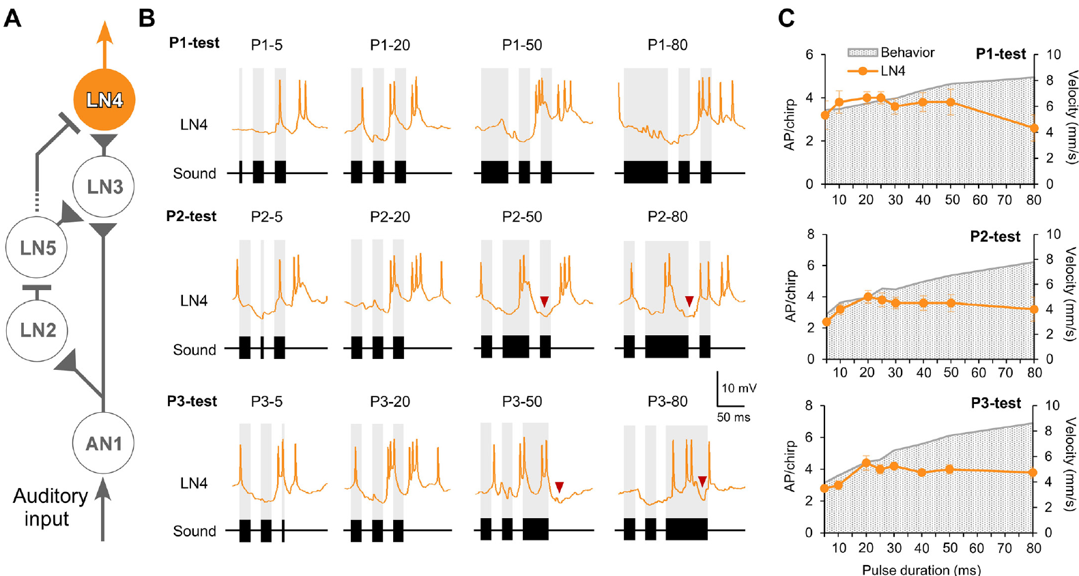
Long pulses recruit late inhibition in LN4
The feature-detector neuron LN4 receives excitation and inhibition rather than merely reproducing sound duration. Zhang and Hedwig examined its responses when a single pulse within a chirp was lengthened while neighboring pulse and interval values remained normal.
A long second pulse of 50 or 80 ms elicited an early excitatory burst followed by inhibition. The associated depolarization was restricted to approximately 34 ms, shorter than the ongoing sound. Long third pulses likewise produced brief excitation terminated by inhibition.
This truncation supports a duration-limiting process within neural recognition output, even when behavior remains broadly responsive. The cellular origin of the additional inhibition was not established by a targeted intervention. The response cannot be explained solely by assuming that more sound necessarily produces proportionally more LN4 spikes.
Zhang & Hedwig (2023), Fig. 6(A–C). LN4 activity and pulse-duration tuning.
Zhang & Hedwig (2023)
44
Notes:
• The feature-detector neuron LN4 receives excitation and inhibition rather than merely reproducing sound duration. Zhang and Hedwig examined its responses when a single pulse within a chirp was lengthened while neighboring pulse and interval values remained normal.
• A long second pulse of 50 or 80 ms elicited an early excitatory burst followed by inhibition. The associated depolarization was restricted to approximately 34 ms, shorter than the ongoing sound. Long third pulses likewise produced brief excitation terminated by inhibition.
• This truncation supports a duration-limiting process within neural recognition output, even when behavior remains broadly responsive. The cellular origin of the additional inhibition was not established by a targeted intervention. The response cannot be explained solely by assuming that more sound necessarily produces proportionally more LN4 spikes.
• The yellow LN4 traces and circuit labels are original published colors. The authors distinguish the late inhibitory component from the initial sound-evoked inhibition, leaving its exact pathway unresolved rather than assigning it to an identified new neuron.
References:
Zhang X, Hedwig B (2023). Sound processing in the cricket brain: evidence for a pulse duration filter. Journal of Neurophysiology 130:953–966. https://doi.org/10.1152/jn.00252.2023
Figure: Zhang & Hedwig (2023), Fig. 6(A–C). LN4 activity and pulse-duration tuning.
Figure source: https://doi.org/10.1152/jn.00252.2023

Slide 45
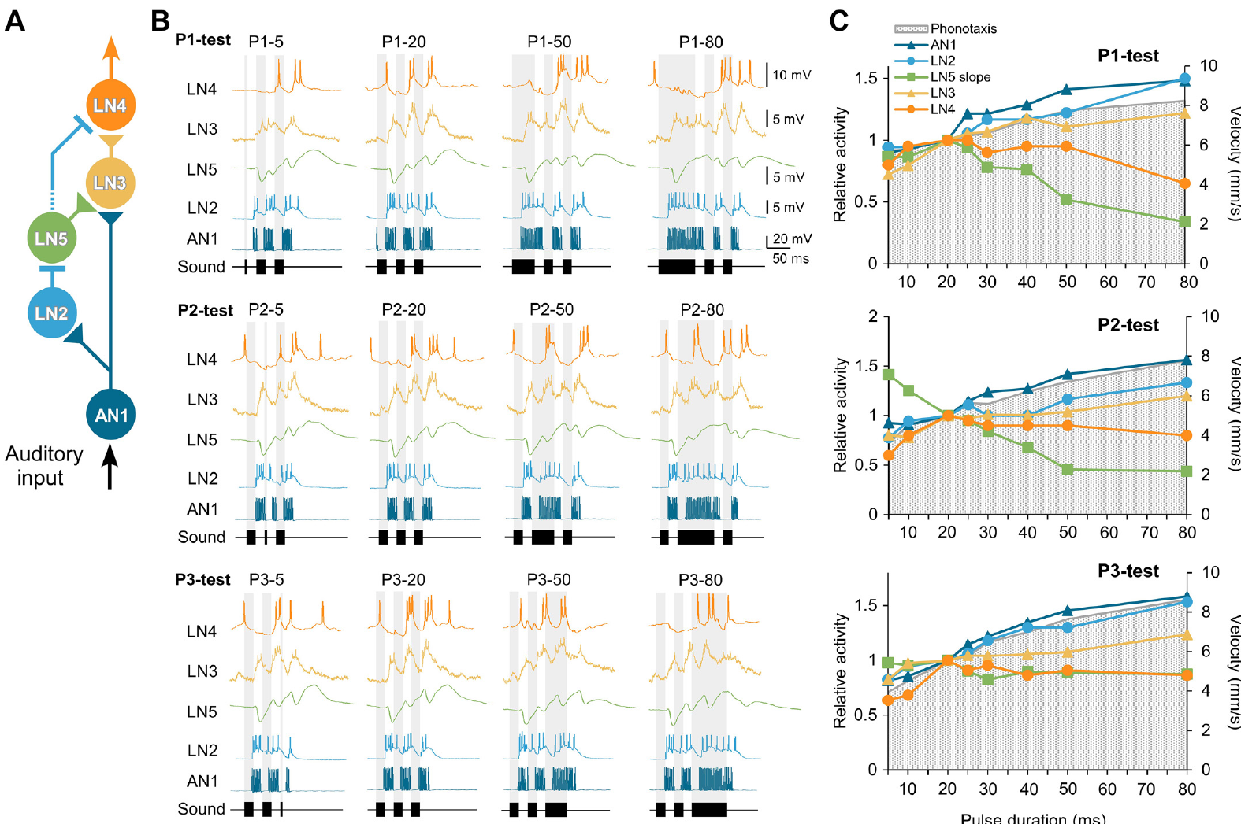
The circuit does not explain every steering response
Zhang and Hedwig compared AN1 and LN2–LN5 with the phonotactic responses to the same pulse-position paradigms. The early pathway tended to increase activity with longer pulses, whereas the final selective output did not match all behavioral changes.
Across 5–80-ms test pulses, AN1 and LN2 output broadly rose with duration, while LN4 responses could decline or remain comparatively restricted. Long pulses also produced additional activity in LN3 and modified LN5 rebound, exposing computations absent from a single uniform pulse-period description.
The five-neuron circuit provides strong physiological evidence for interval recognition but is insufficient as a complete account of context-dependent steering. Additional processing, duration filtering and modulation remain plausible contributions. The study establishes the mismatch and recorded response dynamics without identifying every missing pathway or replacing the original circuit with a fully demonstrated alternative.
Zhang & Hedwig (2023), Fig. 8(A–C). Circuit responses diverge from behavioral tuning.
Zhang & Hedwig (2023)
45
Notes:
• Zhang and Hedwig compared AN1 and LN2–LN5 with the phonotactic responses to the same pulse-position paradigms. The early pathway tended to increase activity with longer pulses, whereas the final selective output did not match all behavioral changes.
• Across 5–80-ms test pulses, AN1 and LN2 output broadly rose with duration, while LN4 responses could decline or remain comparatively restricted. Long pulses also produced additional activity in LN3 and modified LN5 rebound, exposing computations absent from a single uniform pulse-period description.
• The five-neuron circuit provides strong physiological evidence for interval recognition but is insufficient as a complete account of context-dependent steering. Additional processing, duration filtering and modulation remain plausible contributions. The study establishes the mismatch and recorded response dynamics without identifying every missing pathway or replacing the original circuit with a fully demonstrated alternative.
• Evidence for an interval-recognition mechanism and evidence for its limits can coexist. A mismatch between output tuning and behavior constrains completeness, not the existence of the rebound and coincidence phenomena directly recorded in the earlier study.
References:
Zhang X, Hedwig B (2023). Sound processing in the cricket brain: evidence for a pulse duration filter. Journal of Neurophysiology 130:953–966. https://doi.org/10.1152/jn.00252.2023
Figure: Zhang & Hedwig (2023), Fig. 8(A–C). Circuit responses diverge from behavioral tuning.
Figure source: https://doi.org/10.1152/jn.00252.2023

Slide 46
Key takeaways
Inherited matching. Species and hybrid song preferences support inherited sender–receiver matching, but do not identify a shared gene or channel.
Directional acoustics. Foreleg tympana combine external sound with tracheal inputs; contralateral-spiracle phase strongly contributes to forward directionality.
Input and selectivity. Thoracic and ascending cells can copy pulses without recognizing their rhythm; local brain processing creates more selective output.
Rebound and coincidence. LN5 generates intrinsic offset-linked rebound; delayed excitation combines with AN1 input in LN3, and LN4 integrates enhanced excitation with inhibition.
Recognition and steering. Selective recognition and fast directional corrections are distinct interacting processes; net phonotaxis can accumulate from steering toward individual pulses.
Evidence and limits. Proposed connections and molecular mechanisms require their own causal tests, and the five-neuron circuit does not explain all context-dependent pulse-duration responses.
Hoy & Paul (1973); Michelsen et al. (1994); Hedwig & Poulet (2004); Schöneich et al. (2015); Zhang & Hedwig (2023)
46
Notes:
Teaching transcript:
• Inherited matching. Species and hybrid song preferences support inherited sender–receiver matching, but do not identify a shared gene or channel.
• Directional acoustics. Foreleg tympana combine external sound with tracheal inputs; contralateral-spiracle phase strongly contributes to forward directionality.
• Input and selectivity. Thoracic and ascending cells can copy pulses without recognizing their rhythm; local brain processing creates more selective output.
• Rebound and coincidence. LN5 generates intrinsic offset-linked rebound; delayed excitation combines with AN1 input in LN3, and LN4 integrates enhanced excitation with inhibition.
• Recognition and steering. Selective recognition and fast directional corrections are distinct interacting processes; net phonotaxis can accumulate from steering toward individual pulses.
• Evidence and limits. Proposed connections and molecular mechanisms require their own causal tests, and the five-neuron circuit does not explain all context-dependent pulse-duration responses.
References:
Hoy RR, Paul RC (1973). Genetic control of song specificity in crickets. Science 180(4081):82–83. https://doi.org/10.1126/science.180.4081.82
Pollack GS, Hoy RR (1979). Temporal pattern as a cue for species-specific calling song recognition in crickets. Science 204(4391):429–432. https://doi.org/10.1126/science.204.4391.429
Michelsen A, Popov AV, Lewis B (1994). Physics of directional hearing in the cricket Gryllus bimaculatus. Journal of Comparative Physiology A 175:153–164. https://doi.org/10.1007/BF00215111
Wohlers DW, Huber F (1982). Processing of sound signals by six types of neurons in the prothoracic ganglion of the cricket, Gryllus campestris L. Journal of Comparative Physiology A 146:161–173. https://doi.org/10.1007/BF00610234
Selverston AI, Kleindienst HU, Huber F (1985). Synaptic connectivity between cricket auditory interneurons as studied by selective photoinactivation. Journal of Neuroscience 5(5):1283–1292. https://doi.org/10.1523/JNEUROSCI.05-05-01283.1985
Kostarakos K, Hedwig B (2012). Calling song recognition in female crickets: temporal tuning of identified brain neurons matches behavior. Journal of Neuroscience 32(28):9601–9612. https://doi.org/10.1523/JNEUROSCI.1170-12.2012
Schöneich S, Kostarakos K, Hedwig B (2015). An auditory feature detection circuit for sound pattern recognition. Science Advances 1(8):e1500325. https://doi.org/10.1126/sciadv.1500325
Hedwig B, Poulet JFA (2004). Complex auditory behaviour emerges from simple reactive steering. Nature 430(7001):781–785. https://doi.org/10.1038/nature02787
Zhang X, Hedwig B (2023). Sound processing in the cricket brain: evidence for a pulse duration filter. Journal of Neurophysiology 130:953–966. https://doi.org/10.1152/jn.00252.2023

