Slide 1
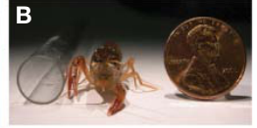
NEUR 411 · NEUROETHOLOGY · FALL 2026
Lecture 35
Social behavior:
crayfish dominance and serotonergic modulation of escape
Wednesday, November 18, 2026
Jordan Lopez, Ph.D.
Professor of Neurobiology & Biomedical Engineering
Herberholz et al. (2011), Fig. 1(B). Juvenile Procambarus clarkii beside a coin.
Notes:
Social behavior: crayfish dominance and serotonergic modulation of escape
Lecture 35. NEUR 411 · NEUROETHOLOGY · FALL 2026. Wednesday, November 18, 2026.
Figure: Herberholz et al. (2011), Fig. 1(B). Juvenile Procambarus clarkii beside a coin.
Figure source: https://doi.org/10.3389/fnbeh.2011.00016
References:
Jens Herberholz; Subrata H. Mishra; Divya Uma; Markus W. Germann; Donald H. Edwards; Kimberlee Potter (2011). Non-Invasive Imaging of Neuroanatomical Structures and Neural Activation with High-Resolution MRI. Frontiers in Behavioral Neuroscience 5:16. https://doi.org/10.3389/fnbeh.2011.00016

Slide 2
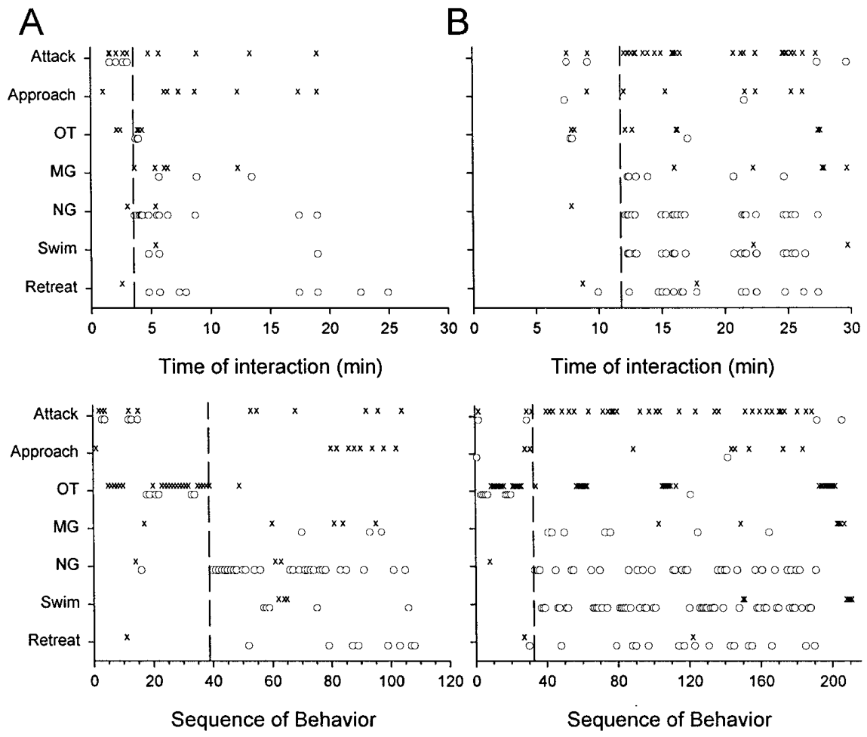
Dominance emerges from changes in social behavior
Crayfish Procambarus clarkii establish dominance, a relationship in which one animal persistently attacks or approaches while the other withdraws. Agonistic behavior comprises conflict-related actions, including threats, grappling, attacks, retreats and escapes. Rank is assigned from these interactions, so the record of each encounter decides who is dominant.
Herberholz and colleagues paired previously isolated juveniles of similar size for 30 min. Synchronized recordings identified an abrupt transition in which the future subordinate stopped contesting and began to withdraw. This transition marks the point at which the hierarchy is formed, and each pair is followed from its first contact onward.
The behavioral sequence around hierarchy formation shows how social roles develop within a short interval. Each animal's actions are scored in order, so the change from contest to retreat appears as a clear turning point. Rank is therefore read from the sequence of interactions rather than from body posture.
Herberholz et al. (2001), Fig. 4(A–B). Behavioral sequences around hierarchy formation.
Herberholz et al. (2001)
02
Notes:
• Crayfish Procambarus clarkii establish dominance, a relationship in which one animal persistently attacks or approaches while the other withdraws. Agonistic behavior comprises conflict-related actions, including threats, grappling, attacks, retreats and escapes. Rank is assigned from these interactions rather than from posture alone.
• Herberholz and colleagues paired previously isolated juveniles of similar size for 30 min. Synchronized recordings identified an abrupt transition: the future subordinate stopped repeated offensive actions and began retreating or escaping from its opponent.
– An attack leads to contact and a response from the other animal. An approach provokes a response without contact, whereas a retreat is locomotion away from the opponent. These operational definitions let the researchers classify behavior without assigning an unmeasured internal intention.
• A hierarchy therefore changes the selection of actions within an encounter. The behavioral transition establishes which animal yields under these conditions, but it does not identify the transmitter or neuronal change responsible. Animals could occasionally reengage after the initial decision, so dominance was assessed across the interaction.
References:
Jens Herberholz; Fadi A. Issa; Donald H. Edwards (2001). Patterns of Neural Circuit Activation and Behavior during Dominance Hierarchy Formation in Freely Behaving Crayfish. The Journal of Neuroscience, 21(8): 2759-2767. https://doi.org/10.1523/jneurosci.21-08-02759.2001
Figure: Herberholz et al. (2001), Fig. 4(A–B). Behavioral sequences around hierarchy formation.
Figure source: https://doi.org/10.1523/jneurosci.21-08-02759.2001

Slide 3
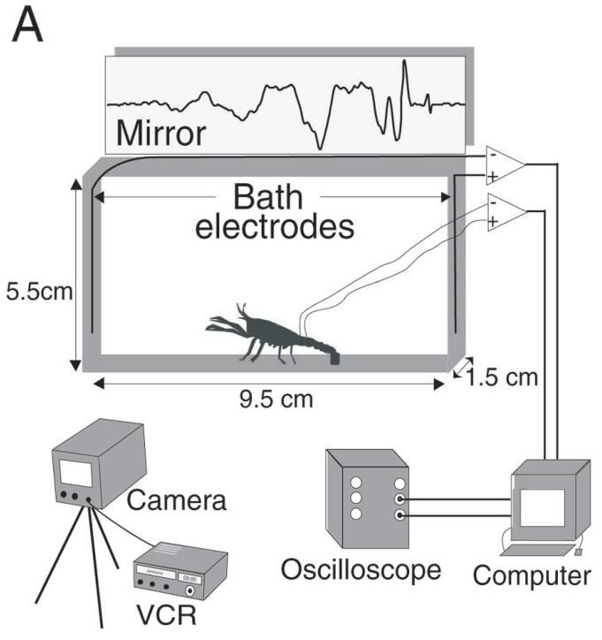
Electrical fields identify activity during free movement
Field potentials are changes in voltage in the water surrounding a freely moving crayfish. Herberholz and colleagues recorded these signals as the animals moved. Large, coordinated neuronal and muscle currents generate them, so neural pathway activation can be associated with the behavior seen in the video.
Bath electrodes at opposite ends of a 9.5 cm aquarium recorded activity while high-speed video sampled movement every 5 ms. Preliminary recordings compared the bath signal with signals from implanted electrodes in the same animal. Corresponding waveforms in both recordings confirmed that the bath signal reflects the same activity.
Combining the bath signal with video allows each escape or grappling event to be placed on a shared clock. The recording method keeps the animal free to move while its neural activity is measured. Each event can then be tied to the movement that produced it.
Herberholz et al. (2001), Fig. 1(A). Bath electrodes and high-speed video recording.
Herberholz et al. (2001)
03
Notes:
• Herberholz and colleagues recorded field potentials, changes in voltage in the water surrounding freely moving crayfish. Large, coordinated neuronal and muscle currents generate these signals, allowing neural pathway activation to be associated with observed behavior.
• Bath electrodes at opposite ends of a 9.5 cm aquarium recorded activity while high-speed video sampled movement every 5 ms. Preliminary recordings compared the bath signal with signals from implanted electrodes in the same animal. Corresponding waveforms supported identification without retaining electrode leads during paired encounters.
– A field recording sums currents rather than measuring the membrane potential of one cell. Synchronizing video and voltage allows a tail flip to be attributed to the animal performing it. The authors did not observe simultaneous tail flips that would prevent this attribution in their paired recordings.
• The method preserved movement and contact between opponents. Waveform similarity validates particular escape signatures; it does not resolve every small neuron contributing to a field potential. Video supplied the animal’s identity and movement trajectory, preventing a voltage event from being classified solely by amplitude.
References:
Jens Herberholz; Fadi A. Issa; Donald H. Edwards (2001). Patterns of Neural Circuit Activation and Behavior during Dominance Hierarchy Formation in Freely Behaving Crayfish. The Journal of Neuroscience, 21(8): 2759-2767. https://doi.org/10.1523/jneurosci.21-08-02759.2001
Figure: Herberholz et al. (2001), Fig. 1(A). Bath electrodes and high-speed video recording.
Figure source: https://doi.org/10.1523/jneurosci.21-08-02759.2001

Slide 4
Field recordings place events on a shared clock
A bath electrode records the voltage changes that a moving crayfish produces in the surrounding water. Because the animal is free to move, its activity can be recorded during natural behavior rather than in a restrained preparation. Each recording is kept on a clock shared with the video.
High-speed video sampled movement every 5 ms, which resolves the fast abdominal movements of escape and grappling. Matching each frame to the electrical record places every event on the same timeline. Each escape or grappling bout is then read in terms of both its movement and its neural activity.
Comparing the bath signal with implanted electrodes in the same animal confirmed that the two signals reflect the same activity. This check gives the bath recording a known basis, so its events can be interpreted with confidence in later analyses.
Herberholz et al. (2001), Fig. 1(A). Bath electrodes and high-speed video recording.
Herberholz et al. (2001)
03a
Notes:
• Bath recordings and video share one clock.
• Recording.
– Field potentials are measured in the water.
– The animal moves freely during recording.
• Video.
– Movement is sampled every 5 ms.
– Each frame is matched to the electrical record.
• Check.
– Implanted electrodes confirmed the bath signal.
– Both reflect the same activity.
• Meaning.
– Events can be read as movement and neural activity together.
– The timeline is shared across all bouts.
• Source values.
– The published recordings and measurements come from the original paper.
– Each result is reported with the condition used in the source.
• Why the measure matters.
– The result separates the measured property from the mechanism that produces it.
– The comparison stays within the same animals, ganglia or cells.
• Interpretation.
– Each result is read within the preparation and social history that produced it.
– The claim is restricted to the measured animals and conditions.
• Context.
– The parent figure shows the measurement that the paragraphs describe.
– Each claim is tied to the recordings of the original study.
• Method.
– The measurements follow the methods described in the original paper.
– Each value is kept with the condition under which it was measured.
References:
Jens Herberholz; Fadi A. Issa; Donald H. Edwards (2001). Patterns of Neural Circuit Activation and Behavior during Dominance Hierarchy Formation in Freely Behaving Crayfish. The Journal of Neuroscience, 21(8): 2759-2767. https://doi.org/10.1523/jneurosci.21-08-02759.2001

Slide 5
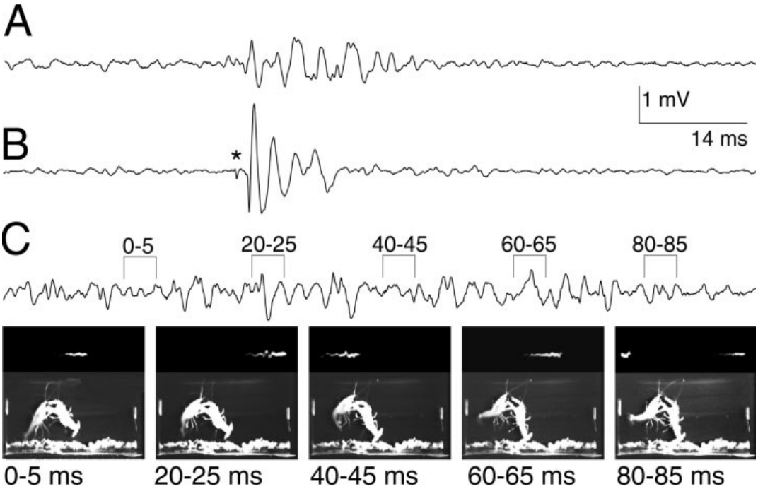
Offensive tail flips prolong contact with an opponent
A tail flip is a rapid abdominal flexion that moves a crayfish through water. During escape it separates the animal from a threat, whereas during an offensive tail flip the animal keeps its grip on the opponent and pulls it upward or over. The two movements look similar but serve different functions in an encounter.
Herberholz and colleagues identified offensive movements using synchronized video and electrical recordings during juvenile encounters. Their abdominal movements began more slowly than ordinary escape flexion and were resolved across successive 5 ms video frames. These events were common during vigorous grappling and appeared alongside continued contact.
An offensive movement therefore prolongs contact with the opponent rather than ending it. Because the movement keeps the animals together, it extends the time over which the encounter can escalate or be resolved. Each event is classified by its timing and by whether contact continued afterward.
Herberholz et al. (2001), Fig. 3(A–C). Escape and offensive tail-flip recordings during encounters.
Herberholz et al. (2001)
04
Notes:
• A tail flip is rapid abdominal flexion that moves a crayfish through water. During escape it separates the animal from a threat; during an offensive tail flip, the animal maintains its grip on the opponent and pulls it upward or over.
• Herberholz and colleagues identified offensive movements using synchronized video and electrical recordings during juvenile encounters. Their abdominal movements began more slowly than ordinary escape flexion and were resolved across successive 5-ms video frames. These events were common during vigorous grappling.
– Maintaining claw contact changes the behavioral consequence of the movement. Slow flexion beginning while the animals remain linked differs from rapidly releasing an escape movement. The absence of a giant signature excludes the usual giant-driven response but does not identify every interneuron in the offensive pathway.
• An offensive movement therefore cannot be assigned an escape function merely because the abdomen flexes. Its electrical signature lacked the large initial giant-pathway response. The authors proposed a distinct motor circuit, but did not identify all of its neurons or prove that it was completely independent of nongiant escape circuitry.
References:
Jens Herberholz; Fadi A. Issa; Donald H. Edwards (2001). Patterns of Neural Circuit Activation and Behavior during Dominance Hierarchy Formation in Freely Behaving Crayfish. The Journal of Neuroscience, 21(8): 2759-2767. https://doi.org/10.1523/jneurosci.21-08-02759.2001
Figure: Herberholz et al. (2001), Fig. 3(A–C). Escape and offensive tail-flip recordings during encounters.
Figure source: https://doi.org/10.1523/jneurosci.21-08-02759.2001

Slide 6
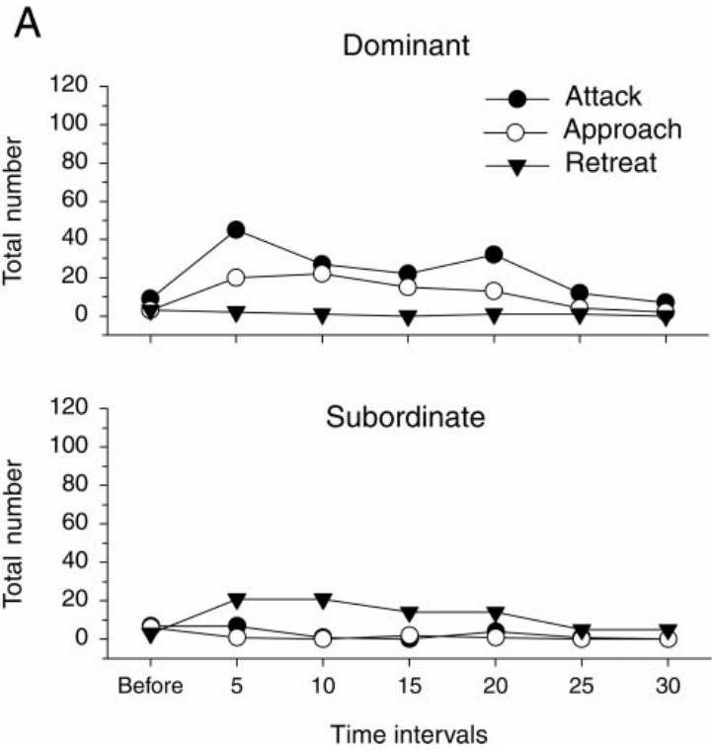
Retreat increases after the hierarchy is decided
The transition to subordinate status redistributes behavior rather than simply reducing all movement. Herberholz and colleagues aligned paired encounters to the first tail flip and counted attacks, approaches and retreats in successive 5 min periods. The alignment keeps the timing of each behavior tied to the same event in every pair.
Dominants maintained attacks and approaches, while subordinates produced repeated retreats and escapes. Aggressive activity then declined across the 30 min observation, reaching roughly 15% of its initial level. Defensive actions fell as approaches and attacks became less frequent, so the two sides of the encounter changed together.
The temporal association links defensive behavior to the opponent's continued attacks. Retreat becomes the dominant response once the hierarchy is decided, and each count is compared with the period in which it occurred. This comparison shows how the balance of actions shifts across the encounter.
Herberholz et al. (2001), Fig. 5(A). Attacks, approaches and retreats across 5-min periods.
Herberholz et al. (2001)
05
Notes:
• The transition to subordinate status redistributes behavior rather than simply reducing all movement. Herberholz and colleagues aligned paired encounters to the first tail flip and counted attacks, approaches and retreats in successive 5-min periods.
• Dominants maintained attacks and approaches while subordinates produced repeated retreats and escapes. Aggressive activity then declined across the 30-min observation, reaching roughly 15% of its initial level. Defensive actions fell as approaches and attacks became less frequent.
– The measurements concern the frequency of defined actions, not a global measure of fear or motor capacity. Less fighting after rank determination can coexist with continuing approaches by the dominant. A subordinate’s withdrawal is therefore evaluated in the context of the opportunities for interaction.
• The temporal association links defensive behavior to the opponent’s actions and the established relationship. It does not establish that a fall in one escape reflex caused retreat, because retreat and different forms of escape recruit different circuits. An animal can suppress one stereotyped response while increasing another defensive action, especially when threats remain predictable during repeated encounters.
References:
Jens Herberholz; Fadi A. Issa; Donald H. Edwards (2001). Patterns of Neural Circuit Activation and Behavior during Dominance Hierarchy Formation in Freely Behaving Crayfish. The Journal of Neuroscience, 21(8): 2759-2767. https://doi.org/10.1523/jneurosci.21-08-02759.2001
Figure: Herberholz et al. (2001), Fig. 5(A). Attacks, approaches and retreats across 5-min periods.
Figure source: https://doi.org/10.1523/jneurosci.21-08-02759.2001

Slide 7
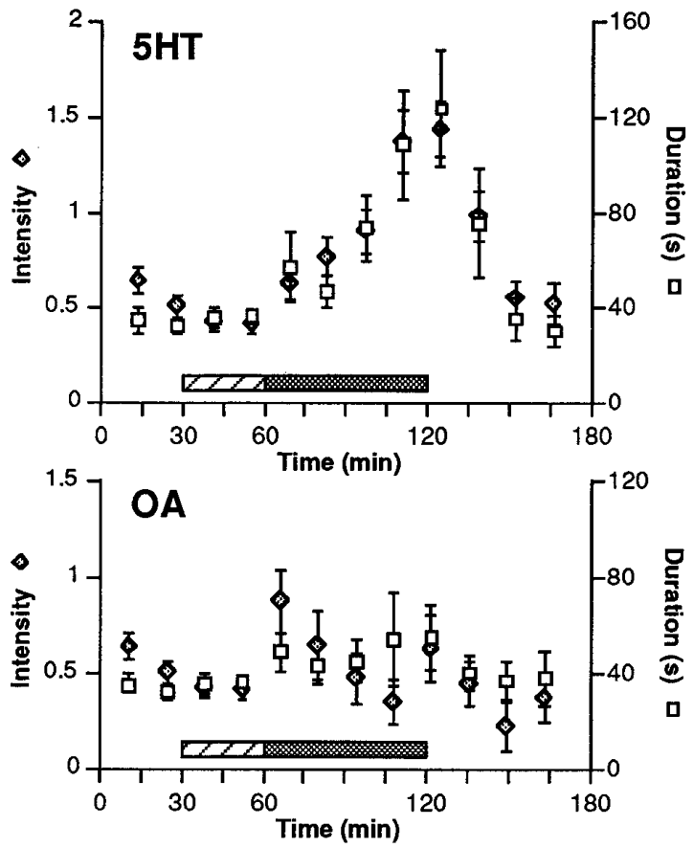
Serotonin prolongs fighting in an established subordinate
Serotonin, or 5-hydroxytryptamine (5-HT), is a monoamine, a small amine-containing signaling molecule that can change neuronal responsiveness. A neuromodulator alters how a circuit responds to its inputs rather than necessarily triggering one fixed action. Huber and colleagues infused serotonin into freely moving Astacus astacus to test its effect on fighting.
The treated subordinate was about 30% smaller than its opponent. After rank formation, 30 min of saline infusion preceded 60 min of serotonin delivery, so each pair served as its own control. Estimated circulating serotonin approached 10 µM, and fight duration and intensity increased during the infusion.
The result shows that serotonin can prolong fighting in an animal that has already become subordinate. The saline period before the infusion provides the baseline for each pair. Each pair's fight duration is compared with its own preinfusion level, which isolates the effect of the drug.
Huber et al. (1997), Fig. 1. Fighting during saline, serotonin and octopamine infusion.
Huber et al. (1997)
06
Notes:
• Serotonin, or 5-hydroxytryptamine (5-HT), is a monoamine, a small amine-containing signaling molecule that can change neuronal responsiveness. A neuromodulator alters how a circuit responds to its inputs rather than necessarily triggering one fixed action. Huber and colleagues infused serotonin into freely moving Astacus astacus.
• The treated subordinate was about 30% smaller than its opponent. After rank formation, 30 min of saline infusion preceded 60 min of serotonin delivery. Estimated circulating serotonin approached 10 µM. Fight duration and intensity increased to approximately three times their pretreatment levels.
– The hemolymph is the circulating fluid of the open circulatory system. Delivery into that fluid exposes multiple tissues, so the experiment cannot assign the behavioral change to one receptor or neuron. The estimated concentration describes circulation during infusion, not a measured concentration at a central synapse.
• Fighting returned toward baseline within 30 min after infusion ended. The saline phase controlled for infusion and time in the apparatus. These results establish a pharmacological increase in fighting persistence, but not that endogenous serotonin concentration alone determines rank or reverses physical superiority.
References:
Robert Huber; Kalim Smith; Antonia Delago; Karin Isaksson; Edward A. Kravitz (1997). Serotonin and aggressive motivation in crustaceans: Altering the decision to retreat. Proceedings of the National Academy of Sciences, 94(11): 5939-5942. https://doi.org/10.1073/pnas.94.11.5939
Figure: Huber et al. (1997), Fig. 1. Fighting during saline, serotonin and octopamine infusion.
Figure source: https://doi.org/10.1073/pnas.94.11.5939

Slide 8
Serotonin's effect depends on a timed infusion
Infusion timing matters when a drug is delivered to a freely moving animal. Huber and colleagues began each infusion after rank had formed, so the effect of serotonin is measured in animals whose social status is already established. The schedule is the same for every pair.
Each pair served as its own control, with 30 min of saline before 60 min of serotonin delivery. Estimated circulating serotonin approached 10 µM during the infusion. Fight duration and intensity increased while the drug was delivered, and the increase is measured against the saline period.
The infusion design isolates serotonin's effect on an established subordinate. The saline baseline and the drug period belong to the same animals, so each pair's change can be attributed to the drug. Each fight is compared with that pair's own preinfusion level.
Huber et al. (1997), Fig. 1. Fighting during saline, serotonin and octopamine infusion.
Huber et al. (1997)
06a
Notes:
• A timed infusion isolates the effect of serotonin.
• Schedule.
– Infusion began after rank formation.
– The schedule was the same for each pair.
• Control.
– Each pair served as its own control.
– Saline came before serotonin.
• Concentration.
– Estimated serotonin approached 10 µM.
– Fight duration increased during delivery.
• Meaning.
– The drug effect is measured within each pair.
– The baseline belongs to the same animals.
• Source values.
– The published recordings and measurements come from the original paper.
– Each result is reported with the condition used in the source.
• Why the measure matters.
– The result separates the measured property from the mechanism that produces it.
– The comparison stays within the same animals, ganglia or cells.
• Interpretation.
– Each result is read within the preparation and social history that produced it.
– The claim is restricted to the measured animals and conditions.
• Context.
– The parent figure shows the measurement that the paragraphs describe.
– Each claim is tied to the recordings of the original study.
• Method.
– The measurements follow the methods described in the original paper.
– Each value is kept with the condition under which it was measured.
References:
Robert Huber; Kalim Smith; Antonia Delago; Karin Isaksson; Edward A. Kravitz (1997). Serotonin and aggressive motivation in crustaceans: Altering the decision to retreat. Proceedings of the National Academy of Sciences, 94(11): 5939-5942. https://doi.org/10.1073/pnas.94.11.5939

Slide 9
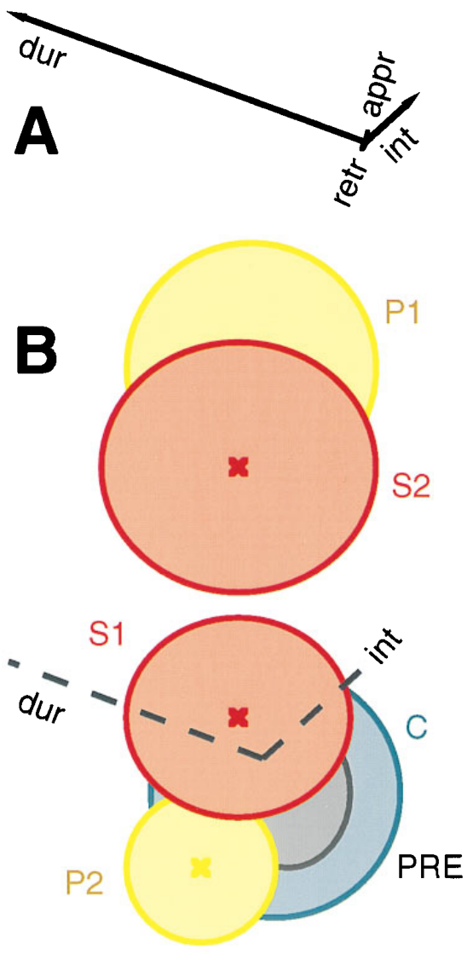
Longer fighting reflects a reduced tendency to withdraw
Fighting intensity and duration are coupled, because encounters that continue longer have more opportunity to escalate. Huber and colleagues therefore separated persistence from which animal initiated an encounter, from the escalation sequence and from which animal ultimately retreated. Each of these features is scored separately for every fight.
During the 60 min serotonin infusion, duration accounted for most of the behavioral change. Subordinates continued contesting interactions longer, while the original opponent usually retained the eventual advantage. The saline and postinfusion periods provided within-pair comparisons, so the change is measured against each pair's own baseline.
The result supports a reduced tendency to withdraw in the treated subordinate. Persistence is the main effect, and the other measures keep their order. Each fight is therefore characterized by how long it lasted and by who gave up first.
Huber et al. (1997), Fig. 2(A–B). Duration-related changes during serotonin treatment.
Huber et al. (1997)
07
Notes:
• Fighting intensity and duration are coupled: encounters that continue longer have more opportunity to escalate. Huber and colleagues therefore separated persistence from which animal initiated an encounter, the escalation sequence and which animal ultimately retreated.
• During the 60-min serotonin infusion, duration accounted for most of the behavioral change. Subordinates continued contesting interactions longer, while the original opponent usually retained the eventual advantage. The saline and postinfusion periods provided within-pair comparisons.
– Persistence means that withdrawal is delayed after an encounter begins. The authors did not find a corresponding change in which animal initiated interactions or a new rule for escalation. Their interpretation of willingness to fight is grounded in this specific behavioral dissociation rather than a direct measure of motivation.
• The result supports a reduced likelihood of withdrawal during an ongoing interaction. It does not establish increased muscular strength, a reversal of hierarchy or a single general aggression pathway. Applied serotonin changed one component of the animal’s behavior under a particular asymmetry of body size, and that component must be distinguished from the final outcome.
References:
Robert Huber; Kalim Smith; Antonia Delago; Karin Isaksson; Edward A. Kravitz (1997). Serotonin and aggressive motivation in crustaceans: Altering the decision to retreat. Proceedings of the National Academy of Sciences, 94(11): 5939-5942. https://doi.org/10.1073/pnas.94.11.5939
Figure: Huber et al. (1997), Fig. 2(A–B). Duration-related changes during serotonin treatment.
Figure source: https://doi.org/10.1073/pnas.94.11.5939

Slide 10
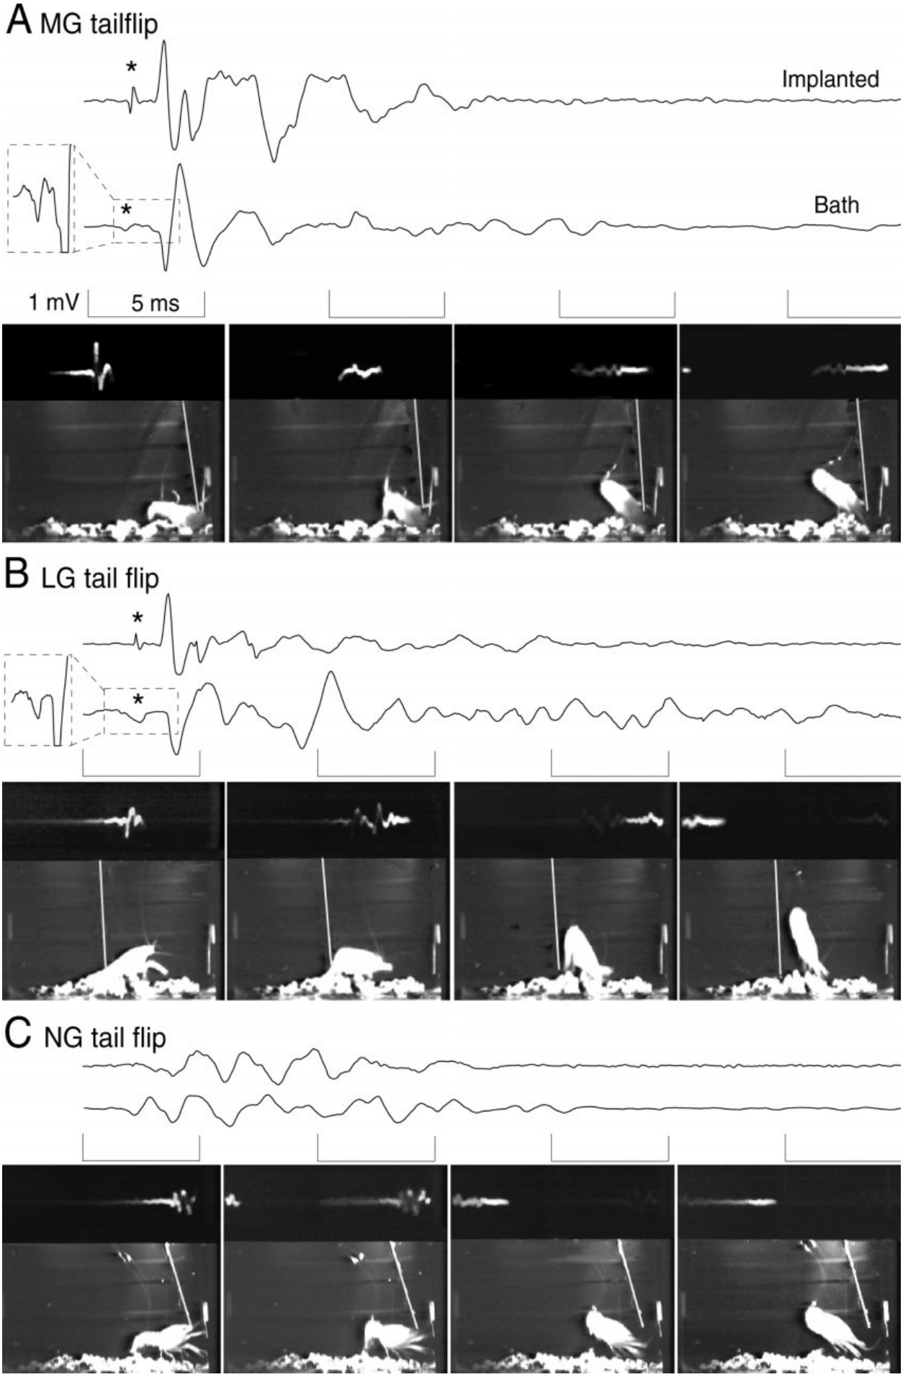
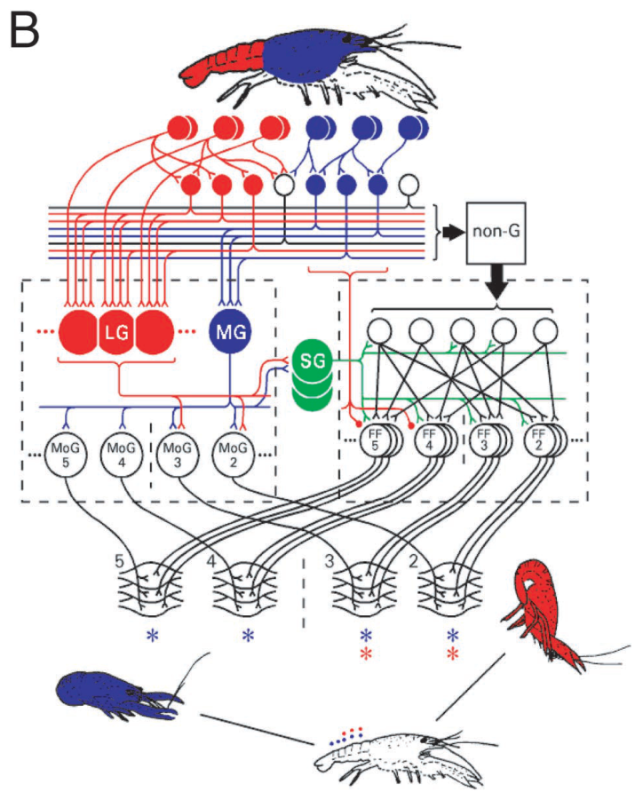
Giant pathways generate different escape trajectories
The lateral giant (LG) and medial giant (MG) are large interneurons that recruit stereotyped escape movements. An interneuron connects neurons within the nervous system, and a command neuron can trigger an organized action when it fires. LG responds chiefly to abrupt abdominal input, whereas MG responds to anterior stimulation.
Herberholz and colleagues compared sharp mechanical stimuli with synchronized recordings. At 25 ms after movement onset, LG tail flips averaged about 99° relative to the animal's forward axis, whereas MG movements averaged about 155°. The two giant pathways therefore produce movements aimed in clearly different directions.
Both pathways produced a giant-type escape, but they turned the body through different angles. The stimulus site determines which giant interneuron is activated, and the resulting direction of escape follows from that choice. Each recorded flip is scored for its angle and assigned to LG or MG.
Herberholz et al. (2001), Fig. 1(B). Published anatomy of giant and nongiant escape pathways.
Herberholz et al. (2001), Fig. 2(A–C). Recorded giant and nongiant tail flips with synchronized video.
Herberholz et al. (2001); Yeh et al. (1997)
08
Notes:
• The lateral giant (LG) and medial giant (MG) are large interneurons that recruit stereotyped escape movements. An interneuron connects neurons within the nervous system; a command neuron can trigger an organized action when it fires. LG responds chiefly to abrupt abdominal input, whereas MG responds to anterior stimulation.
• Herberholz and colleagues compared sharp mechanical stimuli with synchronized recordings. At 25 ms after movement onset, LG tail flips averaged about 99° relative to the animal’s forward axis, whereas MG movements averaged about 155°.
– An action potential is a brief regenerative electrical impulse. LG bends mainly anterior abdominal segments and pitches the animal upward, whereas MG recruits abdominal flexion more broadly and drives a rearward movement. The larger field event includes coordinated motor-neuron and muscle activity rather than an additional LG spike.
• Both pathways produced a giant spike followed about 1.4 ms later by a large motor-related field potential. Their distinct trajectories and electrical signatures supported classification. These calibrated responses identify pathway recruitment, but the threshold for releasing a movement can still depend on ongoing behavior and social experience.
References:
Jens Herberholz; Fadi A. Issa; Donald H. Edwards (2001). Patterns of Neural Circuit Activation and Behavior during Dominance Hierarchy Formation in Freely Behaving Crayfish. The Journal of Neuroscience, 21(8): 2759-2767. https://doi.org/10.1523/jneurosci.21-08-02759.2001
Shih-Rung Yeh; Barbara E. Musolf; Donald H. Edwards (1997). Neuronal Adaptations to Changes in the Social Dominance Status of Crayfish. The Journal of Neuroscience, 17(2): 697-708. https://doi.org/10.1523/jneurosci.17-02-00697.1997
Figure: Herberholz et al. (2001), Fig. 2(A–C). Recorded giant and nongiant tail flips with synchronized video.
Figure source: https://doi.org/10.1523/jneurosci.21-08-02759.2001
Figure: Herberholz et al. (2001), Fig. 1(B). Published anatomy of giant and nongiant escape pathways.
Figure source: https://doi.org/10.1523/jneurosci.21-08-02759.2001

Slide 11
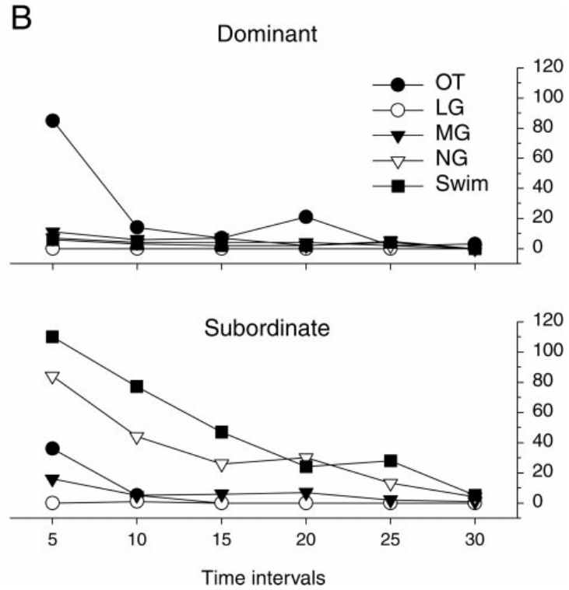
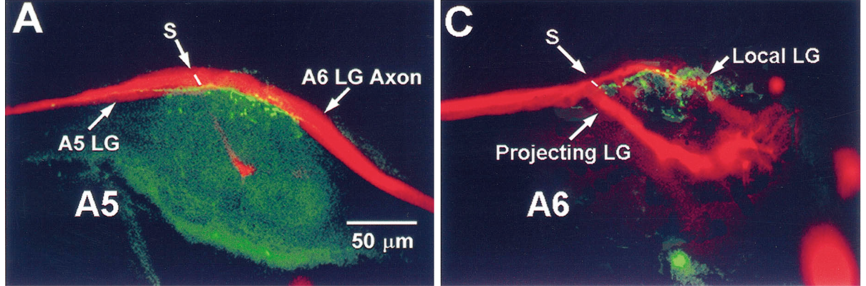
Most social escapes recruit nongiant circuitry
Nongiant escape recruits interneurons and motor neurons without firing the giant command pathways. It produces more variable movements and also contributes to repeated swimming tail flips after an initial escape. A motor neuron carries neural output to a muscle, so the nongiant movements are driven by motor neurons directly.
During 30 min juvenile encounters, Herberholz and colleagues observed extensive nongiant escape and swimming in the new subordinate. LG fired only once across their paired encounters, when an opponent directly struck the subordinate's abdomen. MG responses were concentrated during vigorous interaction, which set the timing of those responses.
Frequent defensive escape therefore relies largely on nongiant circuitry rather than on the giant pathways. The contrast shows that a common defensive behavior can arise from a different set of neurons. Each escape is classified by which pathway it used, based on the recorded activity.
Herberholz et al. (2001), Fig. 5(B). Tail-flip pathway recruitment across 5-min periods.
Yeh et al. (1997), Fig. 13(A,C). Dye-filled LG neurons and nearby serotonin-immunoreactive fibers.
Herberholz et al. (2001); Yeh et al. (1997)
09
Notes:
• Nongiant escape recruits interneurons and motor neurons without firing the giant command pathways. It produces more variable movements and also contributes to repeated swimming tail flips after an initial escape. A motor neuron carries neural output to muscle.
• During 30-min juvenile encounters, Herberholz and colleagues observed extensive nongiant escape and swimming in the new subordinate. LG firing occurred only once across their paired encounters, when an opponent directly struck the subordinate’s abdomen. MG responses were concentrated during vigorous interaction.
– Excitability describes how readily a neuron or circuit responds to stimulation. A change in the frequency of natural responses can reflect changes in sensory input as well as circuit threshold. The rarity of LG activation is therefore a pathway-specific observation, not a direct measurement of serotonin release.
• Frequent defensive movement therefore does not imply frequent LG activation. Field potentials lacking the giant spike and large initial motor signature distinguished nongiant responses. The observed recruitment pattern supports selective control of escape pathways, but it cannot by itself determine whether serotonergic modulation or another signal changed their excitability.
References:
Jens Herberholz; Fadi A. Issa; Donald H. Edwards (2001). Patterns of Neural Circuit Activation and Behavior during Dominance Hierarchy Formation in Freely Behaving Crayfish. The Journal of Neuroscience, 21(8): 2759-2767. https://doi.org/10.1523/jneurosci.21-08-02759.2001
Shih-Rung Yeh; Barbara E. Musolf; Donald H. Edwards (1997). Neuronal Adaptations to Changes in the Social Dominance Status of Crayfish. The Journal of Neuroscience, 17(2): 697-708. https://doi.org/10.1523/jneurosci.17-02-00697.1997
Figure: Herberholz et al. (2001), Fig. 5(B). Tail-flip pathway recruitment across 5-min periods.
Figure source: https://doi.org/10.1523/jneurosci.21-08-02759.2001
Figure: Yeh et al. (1997), Fig. 13(A,C). Dye-filled LG neurons and nearby serotonin-immunoreactive fibers.
Figure source: https://doi.org/10.1523/jneurosci.17-02-00697.1997

Slide 12
Nongiant escape dominates social encounters
Nongiant escape uses interneurons and motor neurons without firing the giant command pathways. Its movements are more variable than giant escapes, and it also drives repeated swimming tail flips after an initial escape. This pathway makes up most of the defensive movements in encounters.
Across 30 min of juvenile encounters, the new subordinate produced extensive nongiant escape and swimming. The giant interneuron LG fired only once across the paired encounters, when an opponent struck the abdomen directly. Such strikes are rare during the rest of the contest.
Frequent defensive escape therefore depends mainly on nongiant circuitry. Each escape is classified by the pathway it used, and the classification follows the recorded activity of the giant and nongiant neurons. Each classification is checked against the timing of the recorded giant-neuron activity.
Herberholz et al. (2001), Fig. 5(B). Tail-flip pathway recruitment across 5-min periods.
Yeh et al. (1997), Fig. 13(A,C). Dye-filled LG neurons and nearby serotonin-immunoreactive fibers.
Herberholz et al. (2001)
09a
Notes:
• Most social escapes use nongiant circuitry.
• Nongiant escape.
– It uses interneurons and motor neurons.
– It produces variable movements.
• Swimming.
– Repeated swimming tail flips follow the escape.
– The nongiant pathway drives them.
• LG activity.
– LG fired once across the encounters.
– The strike was the only trigger.
• Meaning.
– Defensive escape relies on nongiant neurons.
– Each escape is classified by its pathway.
• Source values.
– The published recordings and measurements come from the original paper.
– Each result is reported with the condition used in the source.
• Why the measure matters.
– The result separates the measured property from the mechanism that produces it.
– The comparison stays within the same animals, ganglia or cells.
• Interpretation.
– Each result is read within the preparation and social history that produced it.
– The claim is restricted to the measured animals and conditions.
• Context.
– The parent figure shows the measurement that the paragraphs describe.
– Each claim is tied to the recordings of the original study.
• Method.
– The measurements follow the methods described in the original paper.
– Each value is kept with the condition under which it was measured.
References:
Jens Herberholz; Fadi A. Issa; Donald H. Edwards (2001). Patterns of Neural Circuit Activation and Behavior during Dominance Hierarchy Formation in Freely Behaving Crayfish. The Journal of Neuroscience, 21(8): 2759-2767. https://doi.org/10.1523/jneurosci.21-08-02759.2001

Slide 13
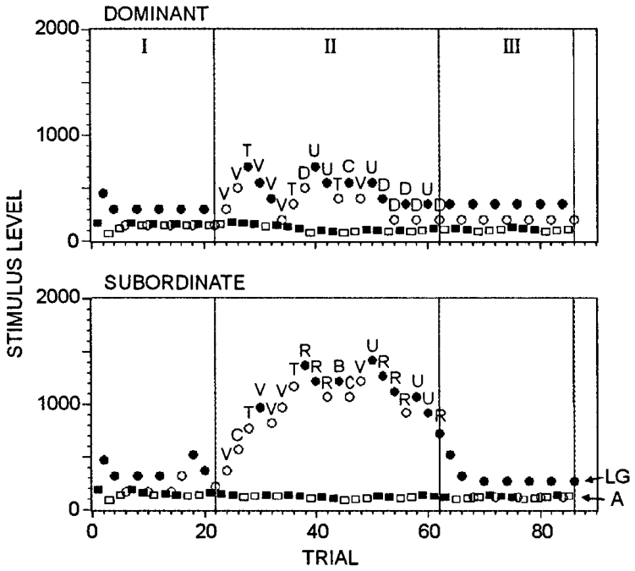
A stimulus threshold measures reflex availability
A stimulus threshold is the smallest input sufficient to elicit a specified response. Krasne and colleagues repeatedly stimulated an abdominal sensory nerve while recording LG-related activity in adult Procambarus clarkii during rest and paired interaction. Each threshold estimate is made from the same nerve and the same recording site.
Test shocks lasted 0.2 ms. The researchers varied shock strength to estimate the level needed to trigger LG, while also monitoring upstream sensory interneuron activity. This separated the availability of the giant reflex from the number of spontaneous escapes produced during an encounter, so the two measures are kept apart.
LG thresholds increased during agonistic activity, especially in subordinates. The threshold change shows that the giant reflex becomes harder to trigger during social conflict. Each animal's threshold is compared with its own resting value, which places the effect of the encounter in a clear context.
Krasne et al. (1997), Fig. 2. LG threshold estimates during rest and social interaction.
Yeh et al. (1997), Fig. 13(A,C). Dye-filled LG neurons and nearby serotonin-immunoreactive fibers.
Krasne et al. (1997); Yeh et al. (1997)
10
Notes:
• A stimulus threshold is the smallest input sufficient to elicit a specified response. Krasne and colleagues repeatedly stimulated an abdominal sensory nerve while recording LG-related activity in adult Procambarus clarkii during rest and paired interaction.
• Test shocks lasted 0.2 ms. The researchers varied shock strength to estimate the level needed to trigger LG, while also monitoring upstream sensory interneuron activity. This separated availability of the giant reflex from the number of spontaneous escapes during an encounter.
– A sensory afferent carries information from a receptor toward the central nervous system. Stimulating its nerve activates an input pathway under controlled conditions. Comparing LG with an upstream interneuron helps locate a change after sensory recruitment rather than treating all failures as loss of afferent excitation.
• LG thresholds increased during agonistic activity, especially in subordinates. A higher threshold means stronger experimental input was needed to release the stereotyped reflex. Electrical nerve stimulation bypasses part of natural stimulus transduction, so its voltage does not directly specify the force of an opponent’s contact or the probability of every escape type.
References:
Franklin B. Krasne; Ashkan Shamsian; Raghavendra Kulkarni (1997). Altered Excitability of the Crayfish Lateral Giant Escape Reflex during Agonistic Encounters. The Journal of Neuroscience, 17(2): 709-716. https://doi.org/10.1523/jneurosci.17-02-00709.1997
Shih-Rung Yeh; Barbara E. Musolf; Donald H. Edwards (1997). Neuronal Adaptations to Changes in the Social Dominance Status of Crayfish. The Journal of Neuroscience, 17(2): 697-708. https://doi.org/10.1523/jneurosci.17-02-00697.1997
Figure: Krasne et al. (1997), Fig. 2. LG threshold estimates during rest and social interaction.
Figure source: https://doi.org/10.1523/jneurosci.17-02-00709.1997
Figure: Yeh et al. (1997), Fig. 13(A,C). Dye-filled LG neurons and nearby serotonin-immunoreactive fibers.
Figure source: https://doi.org/10.1523/jneurosci.17-02-00697.1997

Slide 14
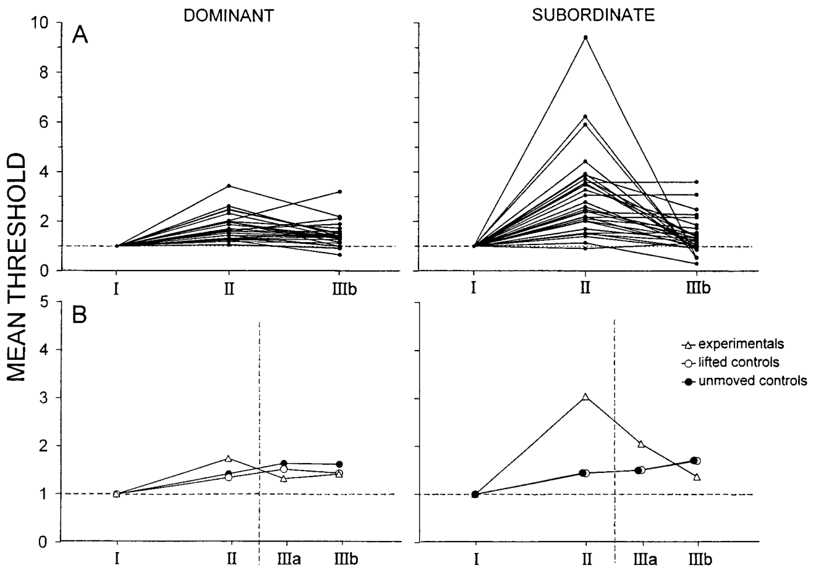
Interaction suppresses LG more strongly in subordinates
Krasne and colleagues compared each animal before, during and after social interaction. Thresholds were normalized to the animal's own resting value, which allows the effect of an encounter to be distinguished from stable differences in electrode placement or stimulus recruitment. Each animal therefore serves as its own reference across all three periods.
LG thresholds rose markedly in subordinates during interaction and rose less in dominants. At rest, reflex excitability did not consistently separate the two ranks. Some subordinate thresholds approached several times baseline and then fell after the interaction ended, showing that the change is tied to the encounter itself.
The same subordinate can retain an available giant reflex during rest while showing suppression during contest. The experience of an encounter therefore changes the reflex threshold in a way that resting measurements alone would miss. Each animal's rank is linked to the timing of its threshold change.
Krasne et al. (1997), Fig. 3(A–B). Normalized LG thresholds in dominant and subordinate animals.
Yeh et al. (1997), Fig. 13(A,C). Dye-filled LG neurons and nearby serotonin-immunoreactive fibers.
Krasne et al. (1997); Yeh et al. (1997)
11
Notes:
• Krasne and colleagues compared each animal before, during and after social interaction. Thresholds were normalized to the animal’s own resting value, allowing the effect of an encounter to be distinguished from stable differences in electrode placement or stimulus recruitment.
• LG thresholds rose markedly in subordinates during interaction and less in dominants. At rest, reflex excitability did not consistently separate the two ranks. Some subordinate thresholds approached several times baseline, then fell after interaction ended.
– Normalizing a threshold to the resting value expresses the change relative to the same preparation. It avoids assuming that equal absolute stimulus voltages recruit identical sensory input in different animals. Social rank and current behavioral context are therefore separate experimental variables.
• The same subordinate can consequently retain an available LG reflex while resting and suppress it during a predictable social threat. This context dependence differs from a permanent loss of the neuron. The experiment established modulation during encounters, but did not measure serotonin release or prove that serotonin produced the observed suppression.
References:
Franklin B. Krasne; Ashkan Shamsian; Raghavendra Kulkarni (1997). Altered Excitability of the Crayfish Lateral Giant Escape Reflex during Agonistic Encounters. The Journal of Neuroscience, 17(2): 709-716. https://doi.org/10.1523/jneurosci.17-02-00709.1997
Shih-Rung Yeh; Barbara E. Musolf; Donald H. Edwards (1997). Neuronal Adaptations to Changes in the Social Dominance Status of Crayfish. The Journal of Neuroscience, 17(2): 697-708. https://doi.org/10.1523/jneurosci.17-02-00697.1997
Figure: Krasne et al. (1997), Fig. 3(A–B). Normalized LG thresholds in dominant and subordinate animals.
Figure source: https://doi.org/10.1523/jneurosci.17-02-00709.1997
Figure: Yeh et al. (1997), Fig. 13(A,C). Dye-filled LG neurons and nearby serotonin-immunoreactive fibers.
Figure source: https://doi.org/10.1523/jneurosci.17-02-00697.1997

Slide 15
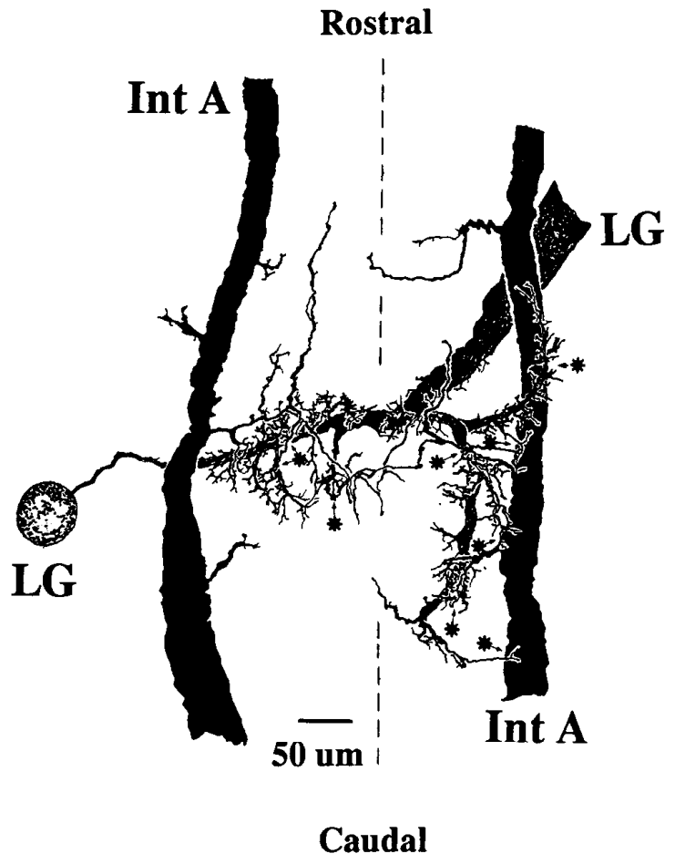
Sensory excitation reaches LG by converging pathways
Abdominal mechanosensory afferents excite LG directly and through sensory interneurons. A monosynaptic pathway contains one synaptic connection, whereas a disynaptic pathway contains two. A synapse is a site of signal transfer between neurons, so the two pathways differ in how many synapses the signal crosses before reaching LG.
Edwards and colleagues combined identified-cell recordings with stained-neuron reconstructions in adult crayfish. Interneuron A overlaps the LG dendritic region and contributes sensory excitation. Nerve shocks produce an early α depolarization followed by a later β component, which reflects the recruitment of interneurons.
An excitatory postsynaptic potential, or EPSP, is a depolarization produced by an excitatory input. The early and late components of the response show which pathway is active at each latency. Each EPSP is attributed to its pathway by its timing and by the interneuron that carries it.
Yeh et al. (1997), Fig. 13(A,C). Dye-filled LG neurons and nearby serotonin-immunoreactive fibers.
Edwards et al. (1991), Fig. 2. Original stained-neuron reconstruction of interneuron A and LG.
Edwards et al. (1991); Yeh et al. (1997)
12
Notes:
• Abdominal mechanosensory afferents excite LG directly and through sensory interneurons. A monosynaptic pathway contains one synaptic connection; a disynaptic pathway contains two. A synapse is a site of signal transfer between neurons.
• Edwards and colleagues combined identified-cell recordings with stained-neuron reconstructions in adult crayfish. Interneuron A overlaps the LG dendritic region and contributes sensory excitation. Nerve shocks produce an early α depolarization followed by a later β component reflecting interneuronal recruitment.
– Dendrites are neuronal processes that receive and integrate inputs, whereas an axon carries output toward other targets. The anatomical reconstruction and the physiological recordings provide complementary evidence: identified processes establish where cells overlap, while electrical coupling establishes that a signal can pass between them.
• An excitatory postsynaptic potential (EPSP) is an input-evoked voltage change favoring neuronal firing. Responses are calibrated in mV and ms, separating signal size from timing. Convergence permits multiple inputs to approach LG firing threshold, but anatomical overlap alone cannot establish a functional synapse or determine which input controls behavior in every context.
References:
DH Edwards; WJ Heitler; EM Leise; RA Fricke (1991). Postsynaptic modulation of rectifying electrical synaptic inputs to the LG escape command neuron in crayfish. The Journal of Neuroscience, 11(7): 2117-2129. https://doi.org/10.1523/jneurosci.11-07-02117.1991
Shih-Rung Yeh; Barbara E. Musolf; Donald H. Edwards (1997). Neuronal Adaptations to Changes in the Social Dominance Status of Crayfish. The Journal of Neuroscience, 17(2): 697-708. https://doi.org/10.1523/jneurosci.17-02-00697.1997
Figure: Edwards et al. (1991), Fig. 2. Original stained-neuron reconstruction of interneuron A and LG.
Figure source: https://doi.org/10.1523/jneurosci.11-07-02117.1991
Figure: Yeh et al. (1997), Fig. 13(A,C). Dye-filled LG neurons and nearby serotonin-immunoreactive fibers.
Figure source: https://doi.org/10.1523/jneurosci.17-02-00697.1997

Slide 16
Two synapses link sensory input to LG
A monosynaptic pathway passes its signal through one synapse, whereas a disynaptic pathway passes through two. The number of synapses sets the delay and the shape of the response in LG. Each pathway is identified by how many synapses separate the sensory input from the giant neuron.
Edwards and colleagues combined identified-cell recordings with stained-neuron reconstructions in adult crayfish. Interneuron A overlaps the LG dendritic region and contributes to the sensory excitation. Nerve shocks produce an early α depolarization and a later β component.
The early and late components of the response show which pathway is active at each latency. The α component follows the direct input, while the β component follows the recruitment of interneurons. Each EPSP is attributed to its pathway by its timing.
Yeh et al. (1997), Fig. 13(A,C). Dye-filled LG neurons and nearby serotonin-immunoreactive fibers.
Edwards et al. (1991), Fig. 2. Original stained-neuron reconstruction of interneuron A and LG.
Edwards et al. (1991)
12a
Notes:
• Two pathways supply sensory input to LG.
• Synapses.
– A synapse transfers a signal between neurons.
– Monosynaptic means one synapse, disynaptic two.
• Reconstruction.
– Identified cells were recorded and stained.
– Interneuron A overlaps the LG dendrites.
• Components.
– The α component is early and the β component is late.
– Each follows a different pathway.
• Meaning.
– Latency reveals which pathway is active.
– Each EPSP is assigned to its pathway.
• Source values.
– The published recordings and measurements come from the original paper.
– Each result is reported with the condition used in the source.
• Why the measure matters.
– The result separates the measured property from the mechanism that produces it.
– The comparison stays within the same animals, ganglia or cells.
• Interpretation.
– Each result is read within the preparation and social history that produced it.
– The claim is restricted to the measured animals and conditions.
• Context.
– The parent figure shows the measurement that the paragraphs describe.
– Each claim is tied to the recordings of the original study.
• Method.
– The measurements follow the methods described in the original paper.
– Each value is kept with the condition under which it was measured.
References:
DH Edwards; WJ Heitler; EM Leise; RA Fricke (1991). Postsynaptic modulation of rectifying electrical synaptic inputs to the LG escape command neuron in crayfish. The Journal of Neuroscience, 11(7): 2117-2129. https://doi.org/10.1523/jneurosci.11-07-02117.1991

Slide 17
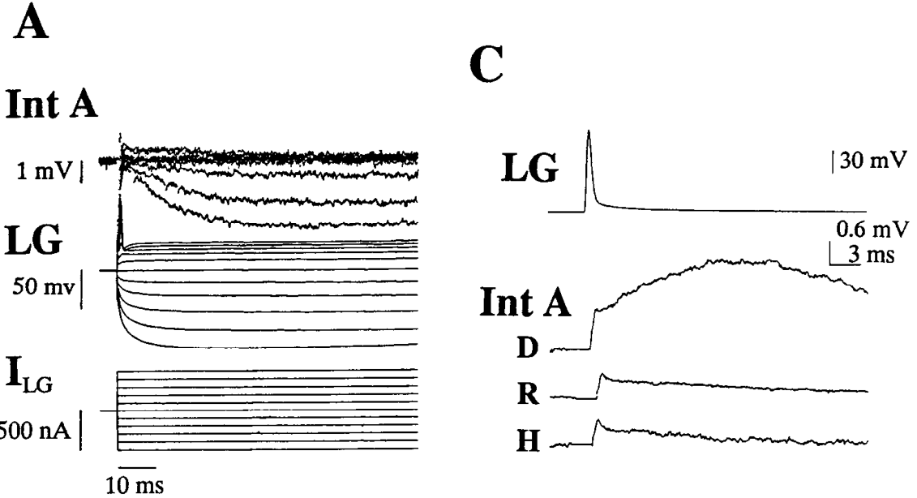
Electrical synapses depend on the voltage difference
An electrical synapse passes current between coupled neurons. Rectification means that transmission depends on the direction and the voltage difference across the connection. A rectifying synapse permits strong forward transmission while transferring much less current in the opposite direction, which gives the connection a preferred direction.
Edwards and colleagues recorded LG and identified sensory interneurons while injecting current to change membrane potential. Shifting the postsynaptic LG voltage altered the transmitted response, even when the presynaptic stimulus was held constant. Their recordings resolved transferred signals on millisecond time scales.
Postsynaptic voltage therefore controls how much of a sensory signal reaches LG through this junction. The direction and size of the transmitted response depend on the membrane state of the receiving cell. Each transmitted signal is measured against the LG voltage at the time it arrived.
Edwards et al. (1991), Fig. 4(A,C). Electrical coupling changes with postsynaptic polarization.
Yeh et al. (1997), Fig. 13(A,C). Dye-filled LG neurons and nearby serotonin-immunoreactive fibers.
Edwards et al. (1991); Yeh et al. (1997)
13
Notes:
• An electrical synapse passes current between coupled neurons. Rectification means that transmission depends on the direction and voltage difference across the connection. It permits strong forward transmission without equivalent transfer in the opposite direction.
• Edwards and colleagues recorded LG and identified sensory interneurons while injecting current to change membrane potential. Shifting postsynaptic LG voltage altered the transmitted response even when the presynaptic stimulus was retained. Their recordings resolved transferred signals on millisecond time scales.
– Depolarization makes a cell’s internal voltage less negative, while hyperpolarization makes it more negative. At a rectifying contact, changing one cell’s voltage changes the driving conditions across the connection. The resulting change in coupling can coexist with changes in the cell’s distance from firing threshold.
• Postsynaptic voltage therefore changes the effectiveness of incoming electrical excitation. This is distinct from changing transmitter release at a chemical synapse. The measured rectification constrains how neuromodulation can alter sensory gain, but it does not identify a serotonin receptor or a particular molecular gap-junction protein responsible for the social-status effect.
References:
DH Edwards; WJ Heitler; EM Leise; RA Fricke (1991). Postsynaptic modulation of rectifying electrical synaptic inputs to the LG escape command neuron in crayfish. The Journal of Neuroscience, 11(7): 2117-2129. https://doi.org/10.1523/jneurosci.11-07-02117.1991
Shih-Rung Yeh; Barbara E. Musolf; Donald H. Edwards (1997). Neuronal Adaptations to Changes in the Social Dominance Status of Crayfish. The Journal of Neuroscience, 17(2): 697-708. https://doi.org/10.1523/jneurosci.17-02-00697.1997
Figure: Edwards et al. (1991), Fig. 4(A,C). Electrical coupling changes with postsynaptic polarization.
Figure source: https://doi.org/10.1523/jneurosci.11-07-02117.1991
Figure: Yeh et al. (1997), Fig. 13(A,C). Dye-filled LG neurons and nearby serotonin-immunoreactive fibers.
Figure source: https://doi.org/10.1523/jneurosci.17-02-00697.1997

Slide 18
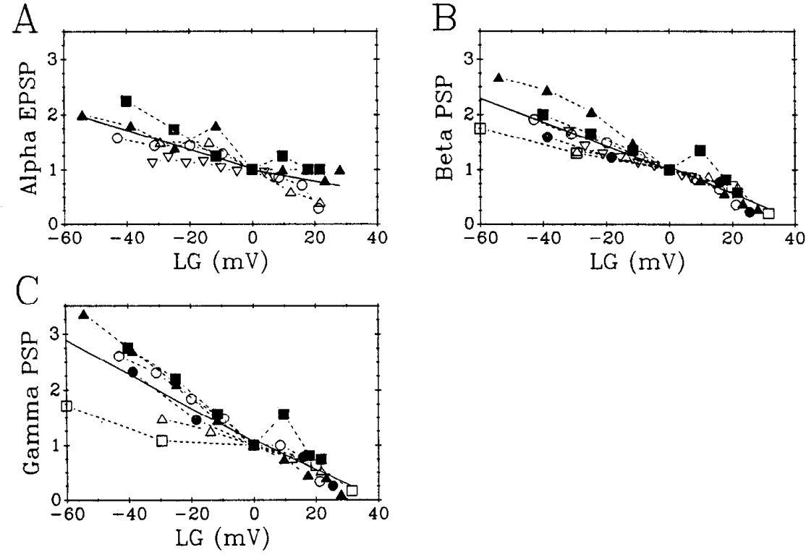
Postsynaptic depolarization can reduce incoming EPSPs
A cell's membrane potential is the voltage inside the cell relative to the outside. Its effect on firing depends both on how close it is to spike threshold and on the transmission of its inputs. Depolarization can change the size of incoming synaptic responses, so the membrane state of the receiving cell is part of the signal.
Edwards and colleagues shifted LG voltage by intracellular current injection while keeping sensory nerve stimulation constant. Across the α, β and later components, hyperpolarizing LG increased EPSP amplitude, whereas depolarizing it reduced amplitude. The plotted membrane shifts span tens of mV relative to rest.
Rectifying electrical contacts therefore make LG responsiveness depend on its own voltage. A small change in membrane potential can alter the size of many incoming responses at once. Each EPSP is compared with the LG voltage recorded at the same moment.
Edwards et al. (1991), Fig. 8(A–C). Sensory EPSPs depend on the LG membrane potential.
Yeh et al. (1997), Fig. 13(A,C). Dye-filled LG neurons and nearby serotonin-immunoreactive fibers.
Edwards et al. (1991); Yeh et al. (1997)
14
Notes:
• A cell’s membrane potential is the voltage inside relative to outside. Its effect on firing depends both on proximity to spike threshold and on the transmission of its inputs. Depolarization does not necessarily enlarge every incoming synaptic response.
• Edwards and colleagues shifted LG voltage by intracellular current injection while retaining sensory nerve stimulation. Across α, β and later components, hyperpolarizing LG increased EPSP amplitude, whereas depolarizing it reduced amplitude. The plotted membrane shifts span tens of mV relative to rest.
– Sensory gain describes how strongly a specified input affects the postsynaptic neuron. Increasing an EPSP and moving the resting potential closer to threshold are different changes, and they can act in opposite directions. Their combined effect must be measured rather than inferred from one voltage shift.
• Rectifying electrical contacts provide a mechanism for this postsynaptic control of input effectiveness. The result cautions against equating depolarization with enhanced sensory gain. It establishes voltage-dependent transmission in this preparation, but the total effect on escape also depends on spike threshold, inhibition and the actual pattern of afferent excitation.
References:
DH Edwards; WJ Heitler; EM Leise; RA Fricke (1991). Postsynaptic modulation of rectifying electrical synaptic inputs to the LG escape command neuron in crayfish. The Journal of Neuroscience, 11(7): 2117-2129. https://doi.org/10.1523/jneurosci.11-07-02117.1991
Shih-Rung Yeh; Barbara E. Musolf; Donald H. Edwards (1997). Neuronal Adaptations to Changes in the Social Dominance Status of Crayfish. The Journal of Neuroscience, 17(2): 697-708. https://doi.org/10.1523/jneurosci.17-02-00697.1997
Figure: Edwards et al. (1991), Fig. 8(A–C). Sensory EPSPs depend on the LG membrane potential.
Figure source: https://doi.org/10.1523/jneurosci.11-07-02117.1991
Figure: Yeh et al. (1997), Fig. 13(A,C). Dye-filled LG neurons and nearby serotonin-immunoreactive fibers.
Figure source: https://doi.org/10.1523/jneurosci.17-02-00697.1997

Slide 19
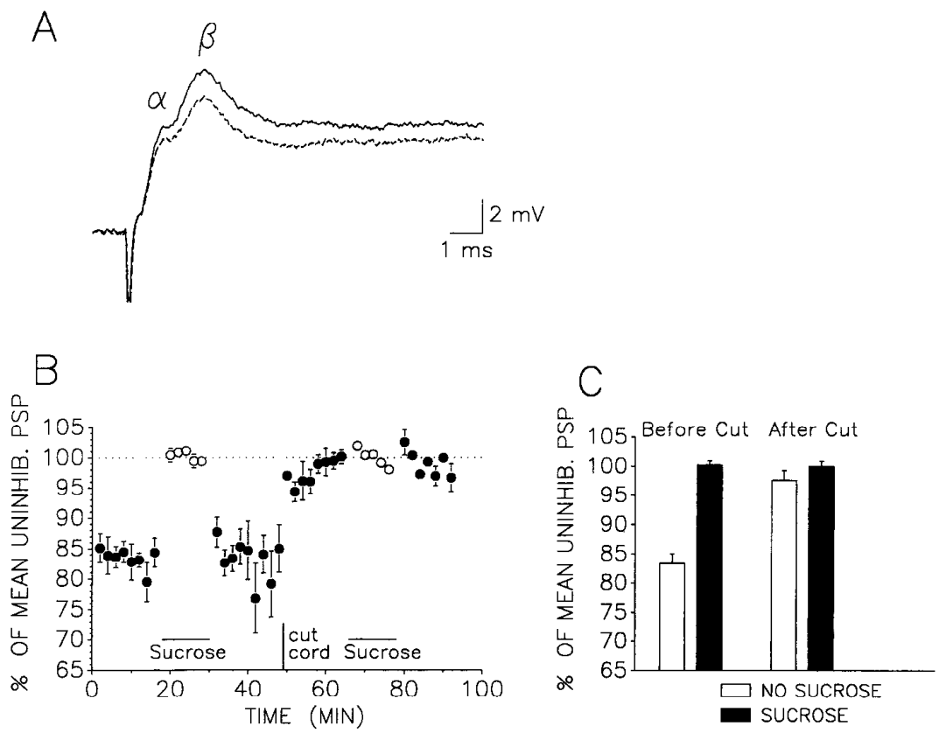
Descending inhibition can suppress escape selectively
Tonic inhibition is sustained suppression of a circuit, distinct from the brief inhibition that accompanies one response. A descending input travels from more anterior nervous-system regions toward abdominal circuits. Vu and colleagues examined this control of LG in restrained crayfish, using a method that keeps the sensory input constant.
They interrupted transmission through a thoracic-abdominal connective with sucrose and then severed it. Sensory-evoked LG EPSPs increased during the reversible block. After severing, another sucrose application produced little additional increase, so the descending influence had already been removed.
The change in EPSPs during the block shows that descending input suppresses the sensory pathway to LG. Voltage responses were compared within the same preparation at each stage. The result identifies a selective route by which escape can be restrained from above.
Vu et al. (1993), Fig. 3(A–C). Sensory EPSPs before and after descending input is interrupted.
Yeh et al. (1997), Fig. 13(A,C). Dye-filled LG neurons and nearby serotonin-immunoreactive fibers.
Vu et al. (1993); Yeh et al. (1997)
15
Notes:
• Tonic inhibition is sustained suppression of a circuit, distinct from the brief inhibition accompanying one response. A descending input travels from more anterior nervous-system regions toward abdominal circuits. Vu and colleagues examined this control of LG in restrained crayfish.
• They interrupted transmission through a thoracic-abdominal connective with sucrose and then severed it. Sensory-evoked LG EPSPs increased during the reversible block; after severing, another sucrose application produced little additional increase. Voltage responses were compared within the same preparation.
– Distal dendritic inhibition can reduce the contribution of selected inputs before their signals reach the spike-initiation region. The proposed selective function differs from recurrent inhibition that prevents another escape from beginning during an ongoing one. The connective block tests the descending source of the suppression, while its spatial location requires additional electrical comparisons.
• The controls locate sustained suppression in an influence carried through the connective. The inhibition increased membrane conductance: incoming current could leave through additional pathways, reducing excitation even though LG was slightly depolarized. Further measurements supported action on distal input regions rather than only near spike initiation. They did not establish that this descending system was the sole cause of social inhibition or that every modulatory effect of serotonin used the same pathway.
References:
ET Vu; SC Lee; FB Krasne (1993). The mechanism of tonic inhibition of crayfish escape behavior: distal inhibition and its functional significance. The Journal of Neuroscience, 13(10): 4379-4393. https://doi.org/10.1523/jneurosci.13-10-04379.1993
Shih-Rung Yeh; Barbara E. Musolf; Donald H. Edwards (1997). Neuronal Adaptations to Changes in the Social Dominance Status of Crayfish. The Journal of Neuroscience, 17(2): 697-708. https://doi.org/10.1523/jneurosci.17-02-00697.1997
Figure: Vu et al. (1993), Fig. 3(A–C). Sensory EPSPs before and after descending input is interrupted.
Figure source: https://doi.org/10.1523/jneurosci.13-10-04379.1993
Figure: Yeh et al. (1997), Fig. 13(A,C). Dye-filled LG neurons and nearby serotonin-immunoreactive fibers.
Figure source: https://doi.org/10.1523/jneurosci.17-02-00697.1997

Slide 20
Descending input suppresses the sensory response
Tonic inhibition is a sustained suppression of a circuit, distinct from the brief inhibition that accompanies one response. A descending input travels from more anterior nervous-system regions toward abdominal circuits, and it can hold the escape pathway in check during rest.
Vu and colleagues interrupted transmission through a thoracic-abdominal connective with sucrose and then severed it. Sensory-evoked LG EPSPs increased during the reversible block. After severing, another sucrose application produced little additional increase, so the descending influence had already been removed.
The increase in EPSPs during the block shows that descending input suppresses the sensory pathway to LG. Voltage responses were compared within the same preparation at each stage, which identifies a selective route by which escape is restrained from above.
Vu et al. (1993), Fig. 3(A–C). Sensory EPSPs before and after descending input is interrupted.
Yeh et al. (1997), Fig. 13(A,C). Dye-filled LG neurons and nearby serotonin-immunoreactive fibers.
Vu et al. (1993)
15a
Notes:
• Descending input holds back the sensory response.
• Tonic inhibition.
– Sustained suppression is distinct from a brief response.
– The input travels from anterior regions.
• Interruption.
– Sucrose blocked the connective reversibly.
– Severing removed the descending input.
• EPSPs.
– Sensory EPSPs increased during the block.
– Severing added little further increase.
• Meaning.
– Escape is restrained from above.
– The route is selective.
• Source values.
– The published recordings and measurements come from the original paper.
– Each result is reported with the condition used in the source.
• Why the measure matters.
– The result separates the measured property from the mechanism that produces it.
– The comparison stays within the same animals, ganglia or cells.
• Interpretation.
– Each result is read within the preparation and social history that produced it.
– The claim is restricted to the measured animals and conditions.
• Context.
– The parent figure shows the measurement that the paragraphs describe.
– Each claim is tied to the recordings of the original study.
• Method.
– The measurements follow the methods described in the original paper.
– Each value is kept with the condition under which it was measured.
References:
ET Vu; SC Lee; FB Krasne (1993). The mechanism of tonic inhibition of crayfish escape behavior: distal inhibition and its functional significance. The Journal of Neuroscience, 13(10): 4379-4393. https://doi.org/10.1523/jneurosci.13-10-04379.1993

Slide 21
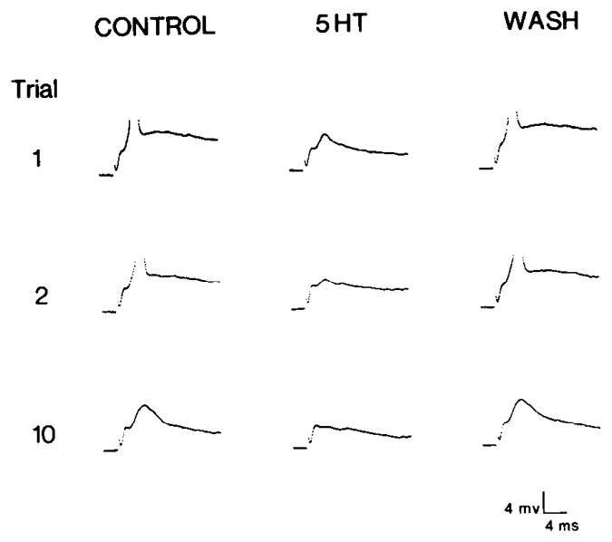
Early serotonin perfusion depressed the giant response
Serotonin perfusion delivers serotonin through the blood supply of the nervous system. Glanzman and Krasne applied serotonin through the ventral arterial supply while recording sensory responses in LG. Their study established an inhibitory effect under those delivery conditions, which sets the baseline for later comparisons across methods.
With 1 mM serotonin perfusion, repeated stimuli delivered every 15 s evoked smaller LG responses, and later stimuli lost their ability to produce spikes. During normal saline, early trials could still fire LG. Washing out serotonin restored responsiveness, which confirms that the drug caused the loss of firing.
The comparison between saline, serotonin and washout keeps each preparation as its own control. The inhibition is clear under these conditions, and the washout shows that it is reversible. Each LG response is compared with the response from the same preparation at another time.
Glanzman & Krasne (1983), Fig. 2. LG responses during saline, serotonin and washout.
Yeh et al. (1997), Fig. 13(A,C). Dye-filled LG neurons and nearby serotonin-immunoreactive fibers.
Glanzman & Krasne (1983); Yeh et al. (1997)
16
Notes:
• Glanzman and Krasne applied serotonin through the ventral arterial supply while recording sensory responses in LG. Their study established an inhibitory effect under its delivery conditions, preceding the discovery that social experience and application schedule could alter the sign.
• With 1 mM serotonin perfusion, repeated stimuli delivered every 15 s evoked smaller LG responses and lost their ability to produce spikes. During normal saline, early trials could still fire LG; washing out serotonin restored responsiveness. The original recordings retain mV and ms calibration.
– Perfusion through an artery distributes the agent differently from bathing an exposed nerve cord. The concentration in the perfusate is not automatically the concentration at LG receptors. Delivery conditions and social history must therefore be recorded before comparisons between experiments are assigned a biological explanation.
• The comparison establishes reversible pharmacological suppression, rather than an irreversible loss of the preparation. Its concentration and route differ from later bath applications. An inhibitory result in this experiment therefore cannot be generalized to every crayfish or taken as a contradiction of facilitation under other exposure conditions.
References:
DL Glanzman; FB Krasne (1983). Serotonin and octopamine have opposite modulatory effects on the crayfish's lateral giant escape reaction. The Journal of Neuroscience, 3(11): 2263-2269. https://doi.org/10.1523/jneurosci.03-11-02263.1983
Shih-Rung Yeh; Barbara E. Musolf; Donald H. Edwards (1997). Neuronal Adaptations to Changes in the Social Dominance Status of Crayfish. The Journal of Neuroscience, 17(2): 697-708. https://doi.org/10.1523/jneurosci.17-02-00697.1997
Figure: Glanzman & Krasne (1983), Fig. 2. LG responses during saline, serotonin and washout.
Figure source: https://doi.org/10.1523/jneurosci.03-11-02263.1983
Figure: Yeh et al. (1997), Fig. 13(A,C). Dye-filled LG neurons and nearby serotonin-immunoreactive fibers.
Figure source: https://doi.org/10.1523/jneurosci.17-02-00697.1997

Slide 22
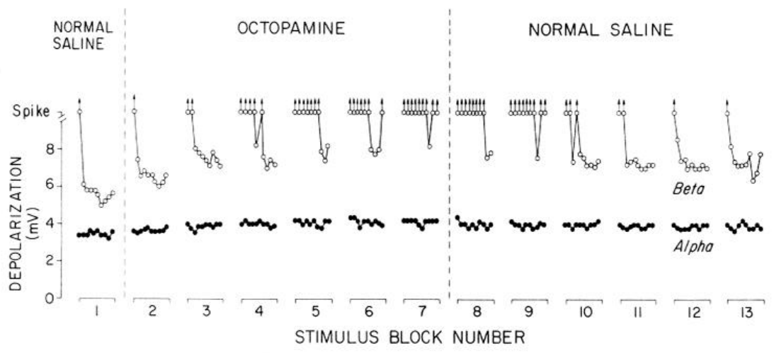
Octopamine enhanced a later component of excitation
Octopamine is another monoamine neuromodulator in arthropods. Glanzman and Krasne compared its effect with serotonin using controlled sensory stimulation and arterial delivery in crayfish. Both compounds acted on the escape system, and their effects differed in which part of the LG response they changed.
During 2 mM octopamine perfusion, the later β component increased, and stimuli that had previously produced subthreshold responses could trigger LG spikes. The early α component changed less. Saline periods before and after treatment provided comparisons within the same preparation.
Additional recordings supported facilitation of the later component by octopamine, rather than a general increase in every response. Each component is measured separately, so the late and early effects are read on their own scales. The octopamine result therefore points to a component-specific action on the escape circuit.
Glanzman & Krasne (1983), Fig. 6. Octopamine increases the later LG response.
Yeh et al. (1997), Fig. 13(A,C). Dye-filled LG neurons and nearby serotonin-immunoreactive fibers.
Glanzman & Krasne (1983); Yeh et al. (1997)
17
Notes:
• Octopamine is another monoamine neuromodulator in arthropods. Glanzman and Krasne compared its effect with serotonin using controlled sensory stimulation and arterial delivery in crayfish. Both compounds acted on the escape system, but their effects were not interchangeable.
• During 2 mM octopamine perfusion, the later β component increased and stimuli that previously produced subthreshold responses could trigger LG spikes. The early α component changed less. Saline periods before and after treatment provided comparisons within the same preparation.
– The β response contains activity that has passed through a sensory interneuron, so it can change when either stage of that pathway is modulated. Comparing the earliest direct component with the later component helps distinguish these possibilities. An escape result cannot be used to assign the same sign to octopamine in every motor network.
• Additional recordings supported facilitation of the afferent-to-interneuron-A connection, whereas serotonin did not produce an equivalent effect there. A larger β response may consequently reflect modulation before LG as well as at LG. The opposite amine effects establish specific physiological actions under these conditions, not universal behavioral identities such as dominance and submission.
References:
DL Glanzman; FB Krasne (1983). Serotonin and octopamine have opposite modulatory effects on the crayfish's lateral giant escape reaction. The Journal of Neuroscience, 3(11): 2263-2269. https://doi.org/10.1523/jneurosci.03-11-02263.1983
Shih-Rung Yeh; Barbara E. Musolf; Donald H. Edwards (1997). Neuronal Adaptations to Changes in the Social Dominance Status of Crayfish. The Journal of Neuroscience, 17(2): 697-708. https://doi.org/10.1523/jneurosci.17-02-00697.1997
Figure: Glanzman & Krasne (1983), Fig. 6. Octopamine increases the later LG response.
Figure source: https://doi.org/10.1523/jneurosci.03-11-02263.1983
Figure: Yeh et al. (1997), Fig. 13(A,C). Dye-filled LG neurons and nearby serotonin-immunoreactive fibers.
Figure source: https://doi.org/10.1523/jneurosci.17-02-00697.1997

Slide 23
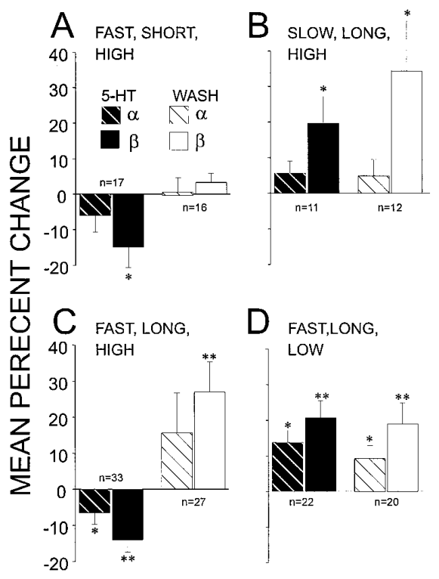
Serotonin dose does not determine its effect alone
Teshiba and colleagues systematically varied serotonin concentration, onset rate and exposure duration in crayfish isolated for at least two weeks. Each of these three factors was changed separately, so their individual contributions to the outcome can be compared. These controls tested why different laboratories had reported opposite effects on LG.
Rapid high-concentration exposure inhibited sensory EPSPs, whereas lower concentrations facilitated them. Juvenile bath concentrations were 5 µM for the low condition and 100 µM for the high condition. Adult arterial concentrations differed because the route of application differed, which shows how delivery shapes the dose that reaches the nerve.
The measured sign therefore depends on the preparation and on the exposure schedule. Concentration, onset and duration interact, so the same drug can inhibit or facilitate the same synapse. Each result is read together with its delivery schedule.
Teshiba et al. (2001), Fig. 3(A–D). Effects of serotonin dose, onset rate and exposure duration.
Yeh et al. (1997), Fig. 13(A,C). Dye-filled LG neurons and nearby serotonin-immunoreactive fibers.
Teshiba et al. (2001); Yeh et al. (1997)
18
Notes:
• Teshiba and colleagues systematically varied serotonin concentration, onset rate and exposure duration in crayfish isolated for at least two weeks. These controls tested why different laboratories had reported opposite effects on LG.
• Rapid high-concentration exposure inhibited sensory EPSPs, whereas lower concentrations facilitated them. Juvenile bath concentrations were 5 µM for the low condition and 100 µM for the high condition. Adult arterial concentrations differed because the route of application differed.
– A bath concentration specifies the solution contacting the exposed tissue, whereas arterial delivery specifies an upstream solution. The study used different nominal concentrations for these routes and compared their qualitative effects. Social isolation did not eliminate inhibitory modulation when serotonin arrived rapidly at a sufficiently high level.
• Thus the measured sign depends on the preparation and exposure schedule as well as the drug’s identity. The experiments establish that an isolated animal has both facilitatory and inhibitory capabilities. They do not provide direct measurements of the receptor occupancy or intracellular molecules mediating each component, and they cannot specify the natural serotonin waveform during an encounter.
References:
Terri Teshiba; Ashkan Shamsian; Bahram Yashar; Shih-Rung Yeh; Donald H. Edwards; Franklin B. Krasne (2001). Dual and Opposing Modulatory Effects of Serotonin on Crayfish Lateral Giant Escape Command Neurons. The Journal of Neuroscience, 21(12): 4523-4529. https://doi.org/10.1523/jneurosci.21-12-04523.2001
Shih-Rung Yeh; Barbara E. Musolf; Donald H. Edwards (1997). Neuronal Adaptations to Changes in the Social Dominance Status of Crayfish. The Journal of Neuroscience, 17(2): 697-708. https://doi.org/10.1523/jneurosci.17-02-00697.1997
Figure: Teshiba et al. (2001), Fig. 3(A–D). Effects of serotonin dose, onset rate and exposure duration.
Figure source: https://doi.org/10.1523/jneurosci.21-12-04523.2001
Figure: Yeh et al. (1997), Fig. 13(A,C). Dye-filled LG neurons and nearby serotonin-immunoreactive fibers.
Figure source: https://doi.org/10.1523/jneurosci.17-02-00697.1997

Slide 24
Concentration and onset set the sign of serotonin
Serotonin concentration, onset rate and exposure duration can each be changed separately. Teshiba and colleagues varied all three in crayfish isolated for at least two weeks, so the contribution of each factor can be compared directly against the others.
Rapid high-concentration exposure inhibited sensory EPSPs, whereas lower concentrations facilitated them. Juvenile bath concentrations were 5 µM for the low condition and 100 µM for the high condition. Adult arterial concentrations differed because the delivery route differed.
The measured sign depends on the preparation and on the exposure schedule. Concentration, onset and duration interact, so the same drug can inhibit or facilitate the same synapse. Each result is read together with its delivery schedule.
Teshiba et al. (2001), Fig. 3(A–D). Effects of serotonin dose, onset rate and exposure duration.
Yeh et al. (1997), Fig. 13(A,C). Dye-filled LG neurons and nearby serotonin-immunoreactive fibers.
Teshiba et al. (2001)
18a
Notes:
• Concentration, onset and duration set the sign of the effect.
• Factors.
– Three factors were varied separately.
– Each contribution can be compared.
• Concentration.
– High rapid exposure inhibited EPSPs.
– Lower concentrations facilitated them.
• Routes.
– Bath and arterial concentrations differed.
– Delivery shapes the dose at the nerve.
• Meaning.
– The same drug can inhibit or facilitate.
– Each result is read with its schedule.
• Source values.
– The published recordings and measurements come from the original paper.
– Each result is reported with the condition used in the source.
• Why the measure matters.
– The result separates the measured property from the mechanism that produces it.
– The comparison stays within the same animals, ganglia or cells.
• Interpretation.
– Each result is read within the preparation and social history that produced it.
– The claim is restricted to the measured animals and conditions.
• Context.
– The parent figure shows the measurement that the paragraphs describe.
– Each claim is tied to the recordings of the original study.
• Method.
– The measurements follow the methods described in the original paper.
– Each value is kept with the condition under which it was measured.
References:
Terri Teshiba; Ashkan Shamsian; Bahram Yashar; Shih-Rung Yeh; Donald H. Edwards; Franklin B. Krasne (2001). Dual and Opposing Modulatory Effects of Serotonin on Crayfish Lateral Giant Escape Command Neurons. The Journal of Neuroscience, 21(12): 4523-4529. https://doi.org/10.1523/jneurosci.21-12-04523.2001

Slide 25
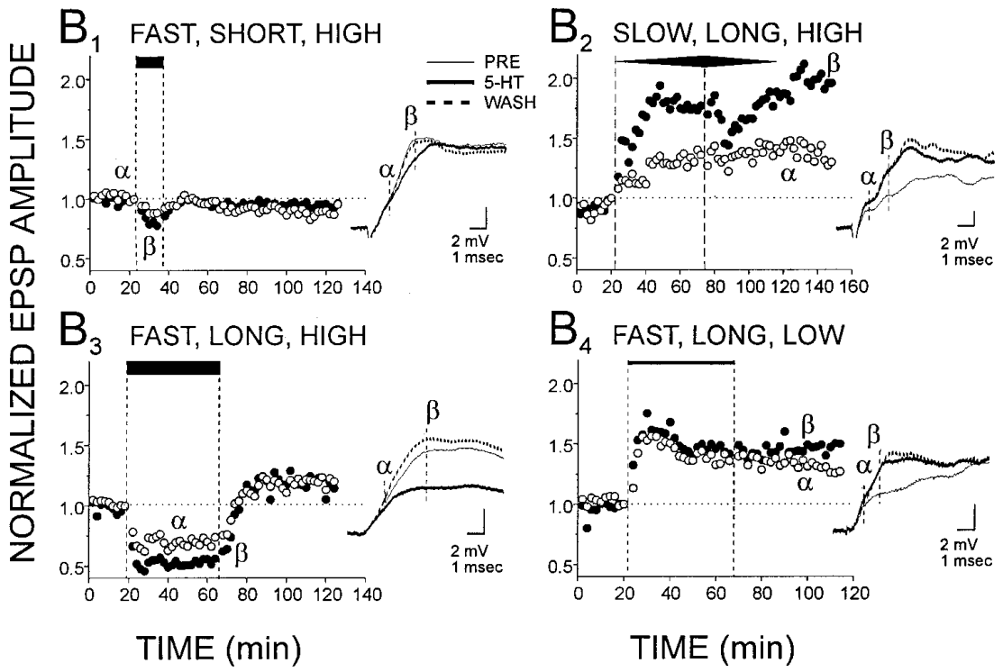
Slow onset favors facilitation at a high concentration
Onset rate describes how rapidly exposure reaches its final level. Teshiba and colleagues compared a rapid serotonin increase with a gradual rise to the same high condition while repeatedly measuring LG sensory EPSPs. Holding the final concentration constant isolates the effect of how quickly the drug arrives.
Fast delivery reached full exposure within roughly 1–2 min, whereas slow delivery took about 20–30 min. The slow, prolonged high exposure facilitated LG instead of producing the inhibition characteristic of a rapid rise. Exposure duration and washout were tracked independently, so each factor is read on its own.
The result supports parallel modulatory processes whose net influence depends on timing. A slowly developing exposure can recruit facilitation that a rapid exposure would not produce. Each response is therefore assigned to its onset rate and compared with the same preparation under the other schedule.
Teshiba et al. (2001), Fig. 1(B1–B4). Recorded LG responses under different serotonin schedules.
Yeh et al. (1997), Fig. 13(A,C). Dye-filled LG neurons and nearby serotonin-immunoreactive fibers.
Teshiba et al. (2001); Yeh et al. (1997)
19
Notes:
• Onset rate describes how rapidly exposure reaches its final level. Teshiba and colleagues compared a rapid serotonin increase with a gradual rise to the same high condition while repeatedly measuring LG sensory EPSPs.
• Fast delivery reached full exposure within roughly 1–2 min. Slow delivery took about 20–30 min. The slow, prolonged high exposure facilitated LG instead of producing the inhibition characteristic of a rapid rise. Exposure duration and washout were tracked independently.
– The final concentration alone omits the tissue’s exposure history. Two preparations can receive the same final solution yet arrive there after different periods of receptor activation and downstream signaling. The source’s mathematical models explored possible interactions, but a successful model is not a molecular identification.
• The result supports parallel modulatory processes whose net influence depends on timing. A slowly developing facilitatory effect can dominate before a higher-threshold inhibitory action becomes substantial. This is a mechanistic interpretation constrained by the recordings; the experiments did not directly identify the proposed interacting signaling molecules or prove their precise biochemical sequence.
References:
Terri Teshiba; Ashkan Shamsian; Bahram Yashar; Shih-Rung Yeh; Donald H. Edwards; Franklin B. Krasne (2001). Dual and Opposing Modulatory Effects of Serotonin on Crayfish Lateral Giant Escape Command Neurons. The Journal of Neuroscience, 21(12): 4523-4529. https://doi.org/10.1523/jneurosci.21-12-04523.2001
Shih-Rung Yeh; Barbara E. Musolf; Donald H. Edwards (1997). Neuronal Adaptations to Changes in the Social Dominance Status of Crayfish. The Journal of Neuroscience, 17(2): 697-708. https://doi.org/10.1523/jneurosci.17-02-00697.1997
Figure: Teshiba et al. (2001), Fig. 1(B1–B4). Recorded LG responses under different serotonin schedules.
Figure source: https://doi.org/10.1523/jneurosci.21-12-04523.2001
Figure: Yeh et al. (1997), Fig. 13(A,C). Dye-filled LG neurons and nearby serotonin-immunoreactive fibers.
Figure source: https://doi.org/10.1523/jneurosci.17-02-00697.1997

Slide 26
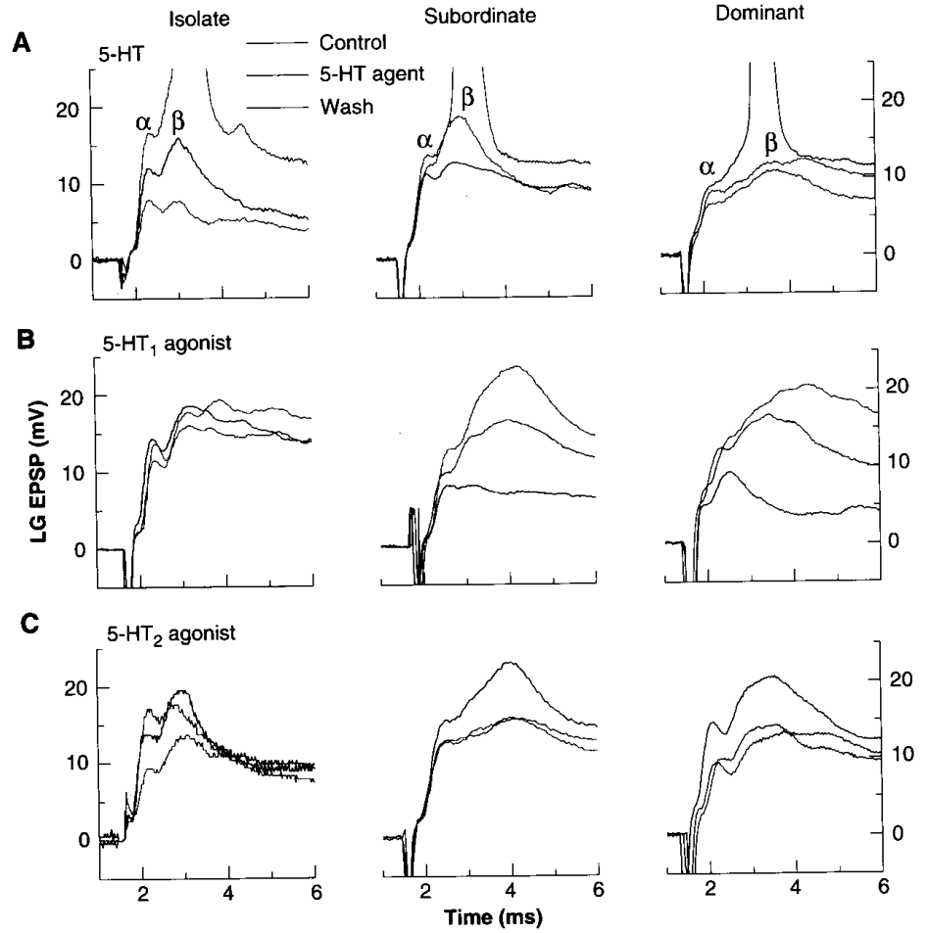
Social experience can reverse serotonin’s effect
Yeh, Fricke and Edwards compared socially isolated, dominant and subordinate crayfish using bath-applied serotonin. Animals were assigned rank from repeated social behavior and paired for at least 12 days before mature status-dependent responses were evaluated. Each animal's history is recorded before its response is measured.
Serotonin at 50 µM enhanced LG sensory responses in isolates and dominants, but reduced them in subordinates. A saline wash removed the effect in paired animals, whereas facilitation in isolates could persist for hours. The same identified neuron and input pathway were tested across all three social conditions.
A transmitter's action therefore depends on the social history of the animal that receives it. The same drug produces opposite effects in animals with different experience, and the identified neuron makes that difference traceable. Each response is linked to the rank and history of its animal.
Yeh et al. (1997), Fig. 13(A,C). Dye-filled LG neurons and nearby serotonin-immunoreactive fibers.
Yeh et al. (1996), Fig. 2(A–C). Serotonin and agonist effects depend on social experience.
Yeh et al. (1996); Yeh et al. (1997)
20
Notes:
• Yeh, Fricke and Edwards compared socially isolated, dominant and subordinate crayfish using bath-applied serotonin. Animals were assigned rank from repeated social behavior and paired for at least 12 days before mature status-dependent responses were evaluated.
• Serotonin at 50 µM enhanced LG sensory responses in isolates and dominants, but reduced them in subordinates. Saline wash removed the effect in paired animals, whereas facilitation in isolates could persist for hours. The same identified neuron and input pathway were tested across social conditions.
– Plasticity is a lasting change in nervous-system function associated with experience. Comparing bath responses after the animals’ histories have differed isolates a property retained by the preparation. The experiment does not require that rank be maintained by a continuously elevated circulating serotonin concentration.
• A transmitter’s action therefore depends on the animal’s prior social experience. The study measured responses to experimentally supplied serotonin; it did not measure endogenous release during fighting. It supports plasticity in serotonergic modulation without establishing that this plasticity alone causes the immediate behavioral decision to withdraw.
References:
Shih-Rung Yeh; Russell A. Fricke; Donald H. Edwards (1996). The Effect of Social Experience on Serotonergic Modulation of the Escape Circuit of Crayfish. Science, 271(5247): 366-369. https://doi.org/10.1126/science.271.5247.366
Shih-Rung Yeh; Barbara E. Musolf; Donald H. Edwards (1997). Neuronal Adaptations to Changes in the Social Dominance Status of Crayfish. The Journal of Neuroscience, 17(2): 697-708. https://doi.org/10.1523/jneurosci.17-02-00697.1997
Figure: Yeh et al. (1996), Fig. 2(A–C). Serotonin and agonist effects depend on social experience.
Figure source: https://doi.org/10.1126/science.271.5247.366
Figure: Yeh et al. (1997), Fig. 13(A,C). Dye-filled LG neurons and nearby serotonin-immunoreactive fibers.
Figure source: https://doi.org/10.1523/jneurosci.17-02-00697.1997

Slide 27
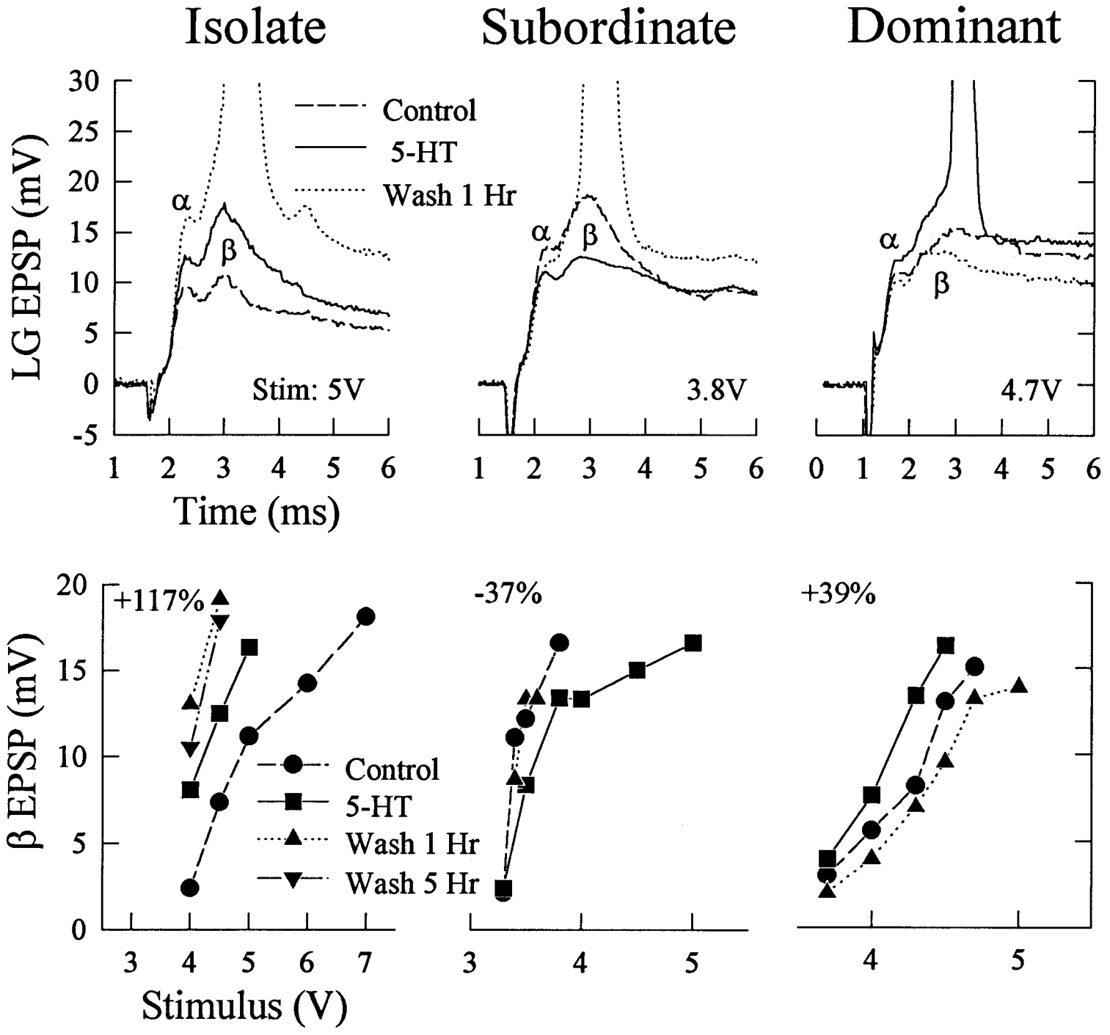
Equal serotonin treatment yields opposite sensory gains
Yeh and colleagues expanded the social-history comparison using identified LG recordings across a range of sensory shock strengths. Subthreshold input evokes a response without a spike, whereas suprathreshold input is sufficient to initiate firing. Testing a range of strengths shows where each animal's firing threshold lies.
After 45 min of 50 µM serotonin superfusion, LG EPSPs increased across stimulus levels in isolates and dominants and decreased in established subordinates. Representative stimulus-response relations changed by about +117%, +39% and −37%, respectively. These values come from individual preparations and show the direction of each change.
The stimulus needed to fire LG is therefore shifted in opposite directions by serotonin, depending on social history. The same drug can lower the firing threshold in one animal and raise it in another. Each stimulus-response relation is compared with the baseline of its own animal.
Yeh et al. (1997), Fig. 2. LG responses and stimulus-response relations by social status.
Yeh et al. (1997), Fig. 13(A,C). Dye-filled LG neurons and nearby serotonin-immunoreactive fibers.
Yeh et al. (1997)
21
Notes:
• Yeh and colleagues expanded the social-history comparison using identified LG recordings across a range of sensory shock strengths. Subthreshold input evokes a response without a spike; suprathreshold input is sufficient to initiate firing.
• After 45 min of 50 µM serotonin superfusion, LG EPSPs increased across stimulus levels in isolates and dominants and decreased in established subordinates. Representative stimulus-response relations changed by about +117%, +39% and −37%, respectively. These are individual examples, not universal effect sizes.
– Testing a range of shocks prevents a change at one selected stimulus level from being mistaken for a general gain change. When an EPSP grows enough to cross threshold, the same physical input can now recruit the giant pathway. Conversely, inhibition can turn a formerly effective stimulus into a subthreshold response.
• The stimulus needed to fire LG consequently fell with facilitation and rose with inhibition. A 1-h saline wash restored paired animals toward baseline. This links synaptic gain to reflex availability, while the controlled shock assay remains distinct from the frequency of natural escapes or the outcome of a social fight.
References:
Shih-Rung Yeh; Barbara E. Musolf; Donald H. Edwards (1997). Neuronal Adaptations to Changes in the Social Dominance Status of Crayfish. The Journal of Neuroscience, 17(2): 697-708. https://doi.org/10.1523/jneurosci.17-02-00697.1997
Figure: Yeh et al. (1997), Fig. 2. LG responses and stimulus-response relations by social status.
Figure source: https://doi.org/10.1523/jneurosci.17-02-00697.1997
Figure: Yeh et al. (1997), Fig. 13(A,C). Dye-filled LG neurons and nearby serotonin-immunoreactive fibers.
Figure source: https://doi.org/10.1523/jneurosci.17-02-00697.1997

Slide 28
Serotonin's sign depends on social history
A subthreshold input evokes a response without a spike, whereas a suprathreshold input is sufficient to initiate firing. Yeh and colleagues tested a range of sensory shock strengths on identified LG neurons, so each animal's firing threshold can be located on a curve.
After 45 min of 50 µM serotonin, LG EPSPs increased across stimulus levels in isolates and dominants and decreased in established subordinates. Representative stimulus-response relations changed by about +117%, +39% and −37%, respectively. These values come from individual preparations.
The stimulus needed to fire LG is shifted in opposite directions by serotonin, depending on social history. The same drug can lower the firing threshold in one animal and raise it in another, so each stimulus-response relation is compared with its own baseline.
Yeh et al. (1997), Fig. 2. LG responses and stimulus-response relations by social status.
Yeh et al. (1997), Fig. 13(A,C). Dye-filled LG neurons and nearby serotonin-immunoreactive fibers.
Yeh et al. (1997)
21a
Notes:
• The same serotonin dose shifts LG in opposite directions.
• Inputs.
– Subthreshold input does not fire LG.
– Suprathreshold input does.
• Exposure.
– Serotonin was applied at 50 µM for 45 min.
– Stimulus strengths were tested across a range.
• Changes.
– Isolates and dominants increased, subordinates decreased.
– The values come from individual preparations.
• Meaning.
– The firing threshold moves in opposite directions.
– Social history sets the direction.
• Source values.
– The published recordings and measurements come from the original paper.
– Each result is reported with the condition used in the source.
• Why the measure matters.
– The result separates the measured property from the mechanism that produces it.
– The comparison stays within the same animals, ganglia or cells.
• Interpretation.
– Each result is read within the preparation and social history that produced it.
– The claim is restricted to the measured animals and conditions.
• Context.
– The parent figure shows the measurement that the paragraphs describe.
– Each claim is tied to the recordings of the original study.
• Method.
– The measurements follow the methods described in the original paper.
– Each value is kept with the condition under which it was measured.
References:
Shih-Rung Yeh; Barbara E. Musolf; Donald H. Edwards (1997). Neuronal Adaptations to Changes in the Social Dominance Status of Crayfish. The Journal of Neuroscience, 17(2): 697-708. https://doi.org/10.1523/jneurosci.17-02-00697.1997

Slide 29
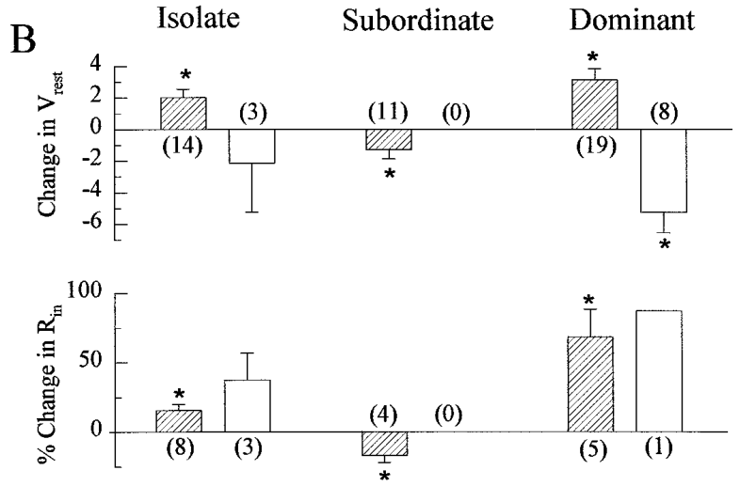
Input resistance changes accompany social modulation
Input resistance describes the voltage change produced by an injected current. Ion channels are membrane proteins that provide paths for ionic current across the membrane. A higher resistance allows a given input current to produce a larger voltage response, whereas a lower resistance allows more current to leave the membrane locally.
Yeh and colleagues measured LG at its initial axon segment before serotonin, during exposure and after a 1 h wash. Isolates and dominants displayed small depolarizations and increased input resistance. Subordinates displayed hyperpolarization and reduced resistance, so the two groups moved in opposite directions.
The changes accompany the social modulation of LG responsiveness, and they follow the same pattern as the EPSP changes. Each animal's resistance is compared with its own baseline before serotonin. The membrane change therefore helps explain how the same drug alters sensory responses in opposite ways.
Yeh et al. (1997), Fig. 3(B). Membrane potential and input-resistance changes by social status.
Yeh et al. (1997), Fig. 13(A,C). Dye-filled LG neurons and nearby serotonin-immunoreactive fibers.
Yeh et al. (1997)
22
Notes:
• Input resistance describes the voltage change produced by an injected current. Ion channels are membrane proteins that provide paths for ionic current. Higher resistance can permit a given input current to produce a larger voltage response; lower resistance permits more current to leave the membrane locally.
• Yeh and colleagues measured LG at its initial axon segment before serotonin, during exposure and after a 1-h wash. Isolates and dominants displayed small depolarizations and increased input resistance; subordinates displayed hyperpolarization and reduced resistance. The changes accompanied their opposite EPSP responses.
– Hyperpolarization makes the cell’s internal voltage more negative. A conductance is the ease with which current passes through a pathway, and increased conductance lowers resistance. The recording location matters because a distal conductance change can affect sensory inputs differently from a change near the electrode.
• The association supports modulation of LG membrane properties, rather than only changing sensory recruitment. Measurement at the axon segment does not fully reveal conductance distribution across all dendrites. These recordings also do not identify the ion-channel species responsible or prove that one resistance change explains every effect on electrical synaptic input.
References:
Shih-Rung Yeh; Barbara E. Musolf; Donald H. Edwards (1997). Neuronal Adaptations to Changes in the Social Dominance Status of Crayfish. The Journal of Neuroscience, 17(2): 697-708. https://doi.org/10.1523/jneurosci.17-02-00697.1997
Figure: Yeh et al. (1997), Fig. 3(B). Membrane potential and input-resistance changes by social status.
Figure source: https://doi.org/10.1523/jneurosci.17-02-00697.1997
Figure: Yeh et al. (1997), Fig. 13(A,C). Dye-filled LG neurons and nearby serotonin-immunoreactive fibers.
Figure source: https://doi.org/10.1523/jneurosci.17-02-00697.1997

Slide 30
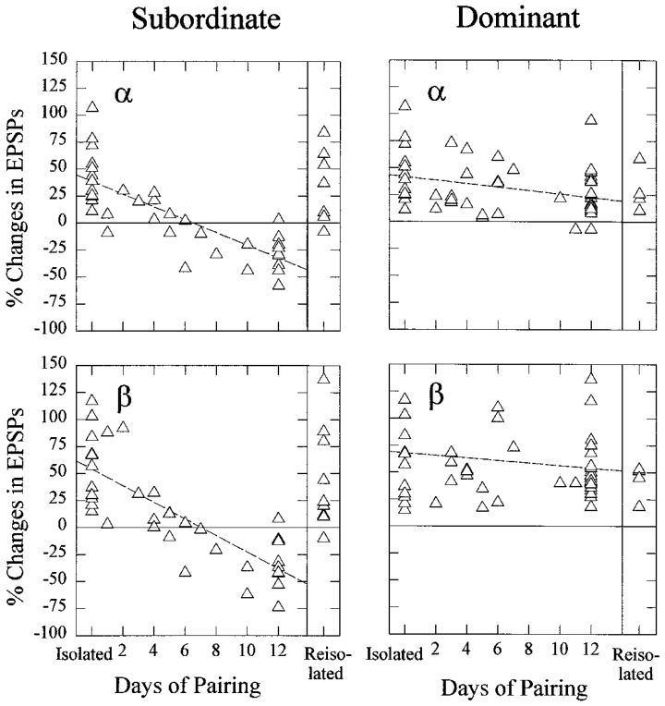
Subordinate modulation develops over days and reverses
The behavioral decision to yield can occur during an early encounter, while serotonin's effect on LG changes more slowly. Yeh and colleagues tested new dominants and subordinates at different times after pairing previously isolated crayfish. Testing at several time points shows how the effect develops across days.
New subordinates initially retained serotonergic facilitation. It declined during the first week and became increasingly inhibitory during the second week. After 12 days of pairing followed by 8 days of renewed isolation, facilitation returned in the former subordinates, so the change is reversible.
This time course separates the acquisition of rank from the acquisition of the mature subordinate response. The behavior of yielding and the cellular change follow different schedules. Each animal's response is plotted against the time since pairing, which shows the two timescales side by side.
Yeh et al. (1997), Fig. 6. Serotonin effects after pairing and subsequent isolation.
Yeh et al. (1997), Fig. 13(A,C). Dye-filled LG neurons and nearby serotonin-immunoreactive fibers.
Yeh et al. (1997)
23
Notes:
• The behavioral decision to yield can occur during an early encounter, while serotonin’s effect on LG changes more slowly. Yeh and colleagues tested new dominants and subordinates at different times after pairing previously isolated crayfish.
• New subordinates initially retained serotonergic facilitation. It declined during the first week and became increasingly inhibitory during the second week. After 12 days of pairing followed by 8 days of renewed isolation, facilitation returned in the former subordinates.
– The preparation retains consequences of prior housing and interaction after removal for recording. Because early subordinate behavior precedes the mature inhibitory response, that inhibitory response cannot be treated as the complete explanation for the first decision to retreat. The reversal establishes plasticity rather than permanent damage.
• This time course separates acquisition of rank from acquisition of the mature cellular response. Reversal after isolation supports an experience-dependent process maintained by continued social conditions. The measurements do not identify the signal that communicates rank to abdominal circuitry or establish that the initial hierarchy decision requires the later inhibitory serotonin response.
References:
Shih-Rung Yeh; Barbara E. Musolf; Donald H. Edwards (1997). Neuronal Adaptations to Changes in the Social Dominance Status of Crayfish. The Journal of Neuroscience, 17(2): 697-708. https://doi.org/10.1523/jneurosci.17-02-00697.1997
Figure: Yeh et al. (1997), Fig. 6. Serotonin effects after pairing and subsequent isolation.
Figure source: https://doi.org/10.1523/jneurosci.17-02-00697.1997
Figure: Yeh et al. (1997), Fig. 13(A,C). Dye-filled LG neurons and nearby serotonin-immunoreactive fibers.
Figure source: https://doi.org/10.1523/jneurosci.17-02-00697.1997

Slide 31
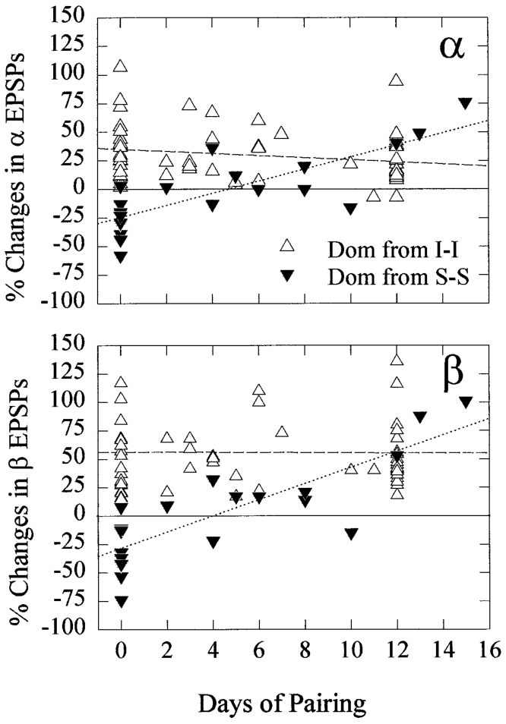
Promotion changes the previously subordinate response
Yeh and colleagues paired former subordinates with one another, allowing one member to acquire dominant status. This manipulation tested whether a retained inhibitory serotonin response could change after a new social relationship developed. Each animal's rank and response are recorded at the same time points.
The newly dominant animal's LG response shifted gradually from serotonin-induced inhibition toward facilitation over about two weeks. The comparison distinguished these animals from new dominants generated by pairing isolates, which already had a facilitatory response from the beginning.
Promotion therefore changes an experienced subordinate's cellular modulation over time. The change follows the new social role rather than the earlier history alone. Each response is compared with the response of new dominants generated from isolates.
Yeh et al. (1997), Fig. 13(A,C). Dye-filled LG neurons and nearby serotonin-immunoreactive fibers.
Yeh et al. (1997), Fig. 7. Former subordinates adapt after becoming dominant.
Yeh et al. (1997)
24
Notes:
• Yeh and colleagues paired former subordinates with one another, allowing one member to acquire dominant status. This manipulation tested whether a retained inhibitory serotonin response could change after a new social relationship developed.
• The newly dominant animal’s LG response shifted gradually from serotonin-induced inhibition toward facilitation over about two weeks. The comparison distinguished these animals from new dominants generated by pairing isolates, which already had a facilitatory response.
– A previous subordinate and a previous isolate can both become dominant while beginning from different modulatory states. Their eventual similarity does not imply identical rates of adaptation. The relevant variable is the sequence of social experiences, not merely the label assigned on the recording day.
• Promotion therefore changes an experienced subordinate’s cellular modulation on a multi-day time scale. The persistence of an older response early after promotion indicates that current behavior and cellular history need not coincide immediately. The experiment establishes adaptation after a status transition, but cannot assign it specifically to receptor abundance, receptor localization or downstream signaling without additional molecular measurements.
References:
Shih-Rung Yeh; Barbara E. Musolf; Donald H. Edwards (1997). Neuronal Adaptations to Changes in the Social Dominance Status of Crayfish. The Journal of Neuroscience, 17(2): 697-708. https://doi.org/10.1523/jneurosci.17-02-00697.1997
Figure: Yeh et al. (1997), Fig. 7. Former subordinates adapt after becoming dominant.
Figure source: https://doi.org/10.1523/jneurosci.17-02-00697.1997
Figure: Yeh et al. (1997), Fig. 13(A,C). Dye-filled LG neurons and nearby serotonin-immunoreactive fibers.
Figure source: https://doi.org/10.1523/jneurosci.17-02-00697.1997

Slide 32
Promotion gradually reverses a subordinate response
Yeh and colleagues paired former subordinates with one another, which allowed one member to acquire dominant status. This manipulation tests whether a retained inhibitory serotonin response changes after a new social relationship develops, and each animal's rank is recorded at the same time points.
The newly dominant animal's LG response shifted gradually from serotonin-induced inhibition toward facilitation over about two weeks. The comparison set these animals against new dominants generated from isolates, which began with a facilitatory response from the outset.
Promotion therefore changes an experienced subordinate's cellular modulation over time. The change follows the new social role, and each response is compared with the response of new dominants generated from isolates.
Yeh et al. (1997), Fig. 13(A,C). Dye-filled LG neurons and nearby serotonin-immunoreactive fibers.
Yeh et al. (1997), Fig. 7. Former subordinates adapt after becoming dominant.
Yeh et al. (1997)
24a
Notes:
• Promotion gradually reverses the inhibitory response.
• Pairing.
– Former subordinates were paired together.
– One member became dominant.
• Time course.
– The LG response shifted over about two weeks.
– Inhibition gave way to facilitation.
• Comparison.
– New dominants from isolates were the reference.
– They began with facilitation.
• Meaning.
– Social role can change cellular modulation.
– The change follows the new role.
• Source values.
– The published recordings and measurements come from the original paper.
– Each result is reported with the condition used in the source.
• Why the measure matters.
– The result separates the measured property from the mechanism that produces it.
– The comparison stays within the same animals, ganglia or cells.
• Interpretation.
– Each result is read within the preparation and social history that produced it.
– The claim is restricted to the measured animals and conditions.
• Context.
– The parent figure shows the measurement that the paragraphs describe.
– Each claim is tied to the recordings of the original study.
• Method.
– The measurements follow the methods described in the original paper.
– Each value is kept with the condition under which it was measured.
References:
Shih-Rung Yeh; Barbara E. Musolf; Donald H. Edwards (1997). Neuronal Adaptations to Changes in the Social Dominance Status of Crayfish. The Journal of Neuroscience, 17(2): 697-708. https://doi.org/10.1523/jneurosci.17-02-00697.1997

Slide 33
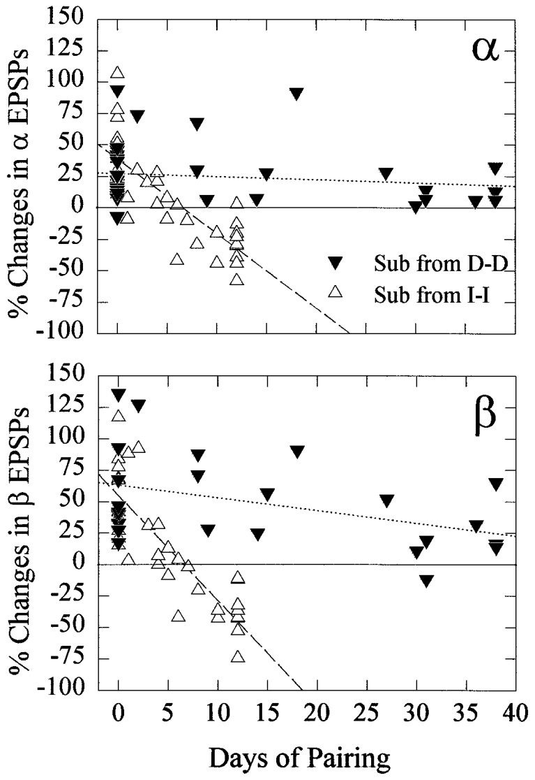
Demotion can leave a long-lasting dominant-like response
Social history can persist after the current rank changes. Yeh and colleagues paired former dominants with one another and subsequently measured serotonin's effect in the animal that had become subordinate. Its behavior was monitored independently of the later neuronal assay, so behavior and physiology are kept separate.
These new subordinates continued to avoid the dominant and to retreat or tail flip on approach. Nevertheless, serotonin still enhanced their LG responses after as much as 38 days of pairing. This pattern differs from that of subordinates produced from initially isolated animals.
The dissociation shows that current behavior and cellular modulation can follow different histories. A former dominant can act as a subordinate while its LG response keeps the dominant-like pattern. Each animal's behavior and LG response are therefore read as separate outcomes. Each animal is scored on its own record.
Yeh et al. (1997), Fig. 13(A,C). Dye-filled LG neurons and nearby serotonin-immunoreactive fibers.
Yeh et al. (1997), Fig. 8. Former dominants retain facilitation after becoming subordinate.
Yeh et al. (1997)
25
Notes:
• Social history can persist after current rank changes. Yeh and colleagues paired former dominants with one another and subsequently measured serotonin’s effect in the animal that had become subordinate. Its behavior was monitored independently of the later neuronal assay.
• These new subordinates continued to avoid the dominant and to retreat or tail flip on approach. Nevertheless, serotonin still enhanced their LG responses after as much as 38 days of pairing, unlike subordinates produced from initially isolated animals.
– The same current subordinate category contains animals with different histories and different serotonergic responses. A mechanistic explanation must therefore account for both experience and its order. The persistence was measured in surviving paired animals, so it does not establish that every demoted dominant follows an identical trajectory.
• The dissociation prevents a one-to-one mapping from current rank to serotonin’s cellular sign. Prior dominance left a modulatory state resistant to reversal under these conditions. It also limits causal claims: dominant-like facilitation of LG is insufficient to guarantee dominant behavior, because the animals expressing it nevertheless behaved as subordinates in their new relationship.
References:
Shih-Rung Yeh; Barbara E. Musolf; Donald H. Edwards (1997). Neuronal Adaptations to Changes in the Social Dominance Status of Crayfish. The Journal of Neuroscience, 17(2): 697-708. https://doi.org/10.1523/jneurosci.17-02-00697.1997
Figure: Yeh et al. (1997), Fig. 8. Former dominants retain facilitation after becoming subordinate.
Figure source: https://doi.org/10.1523/jneurosci.17-02-00697.1997
Figure: Yeh et al. (1997), Fig. 13(A,C). Dye-filled LG neurons and nearby serotonin-immunoreactive fibers.
Figure source: https://doi.org/10.1523/jneurosci.17-02-00697.1997

Slide 34
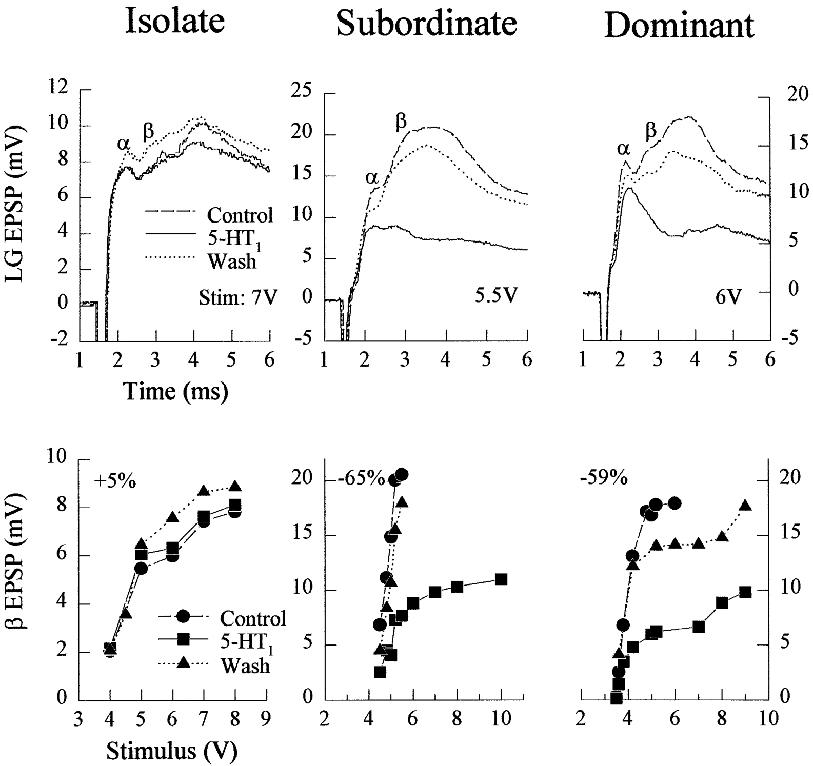
Agonist effects distinguish competing modulatory actions
An agonist activates a receptor-mediated response. Yeh and colleagues substituted drugs historically classified as vertebrate type-1 or type-2 serotonin agonists while keeping LG recording and sensory stimulation fixed. Their classifications were pharmacological hypotheses, which the drug responses could then test in crayfish.
At 50 µM, mCPP reduced LG responses in paired animals but had little effect in isolates. α-Methylserotonin enhanced responses in all three social conditions. Facilitation could persist after a 1 h wash in isolates, whereas paired animals generally recovered toward baseline.
The agonist results separate social history from receptor identity. Two drugs produce different outcomes depending on the animal's rank, which points to more than one modulatory action. Each drug response is compared across the three social conditions.
Yeh et al. (1997), Fig. 9. Responses to the historically designated type-1 agonist.
Yeh et al. (1997), Fig. 13(A,C). Dye-filled LG neurons and nearby serotonin-immunoreactive fibers.
Yeh et al. (1997)
26
Notes:
• An agonist activates a receptor-mediated response. Yeh and colleagues substituted drugs historically classified as vertebrate type-1 or type-2 serotonin agonists while retaining LG recording and sensory stimulation. Their classifications were pharmacological hypotheses, not direct molecular identifications in crayfish.
• At 50 µM, mCPP reduced LG responses in paired animals but had little effect in isolates. α-Methylserotonin enhanced responses in all three social conditions. Facilitation could persist after a 1-h wash in isolates, whereas paired animals generally recovered toward baseline.
– Drug selectivity is the relative strength of its action at different targets. A compound named for a vertebrate receptor can activate a different combination of crustacean targets. Identifying a subtype requires cloned receptors, signaling measurements and localization in addition to the physiological drug response.
• Opposing drug effects support multiple modulatory actions rather than one obligatory response to serotonin. Crayfish receptors can have different drug selectivity from vertebrate receptors. These experiments therefore cannot establish that the named vertebrate receptor subtype is the molecular receptor responsible for LG inhibition or facilitation.
References:
Shih-Rung Yeh; Barbara E. Musolf; Donald H. Edwards (1997). Neuronal Adaptations to Changes in the Social Dominance Status of Crayfish. The Journal of Neuroscience, 17(2): 697-708. https://doi.org/10.1523/jneurosci.17-02-00697.1997
Figure: Yeh et al. (1997), Fig. 9. Responses to the historically designated type-1 agonist.
Figure source: https://doi.org/10.1523/jneurosci.17-02-00697.1997
Figure: Yeh et al. (1997), Fig. 13(A,C). Dye-filled LG neurons and nearby serotonin-immunoreactive fibers.
Figure source: https://doi.org/10.1523/jneurosci.17-02-00697.1997

Slide 35
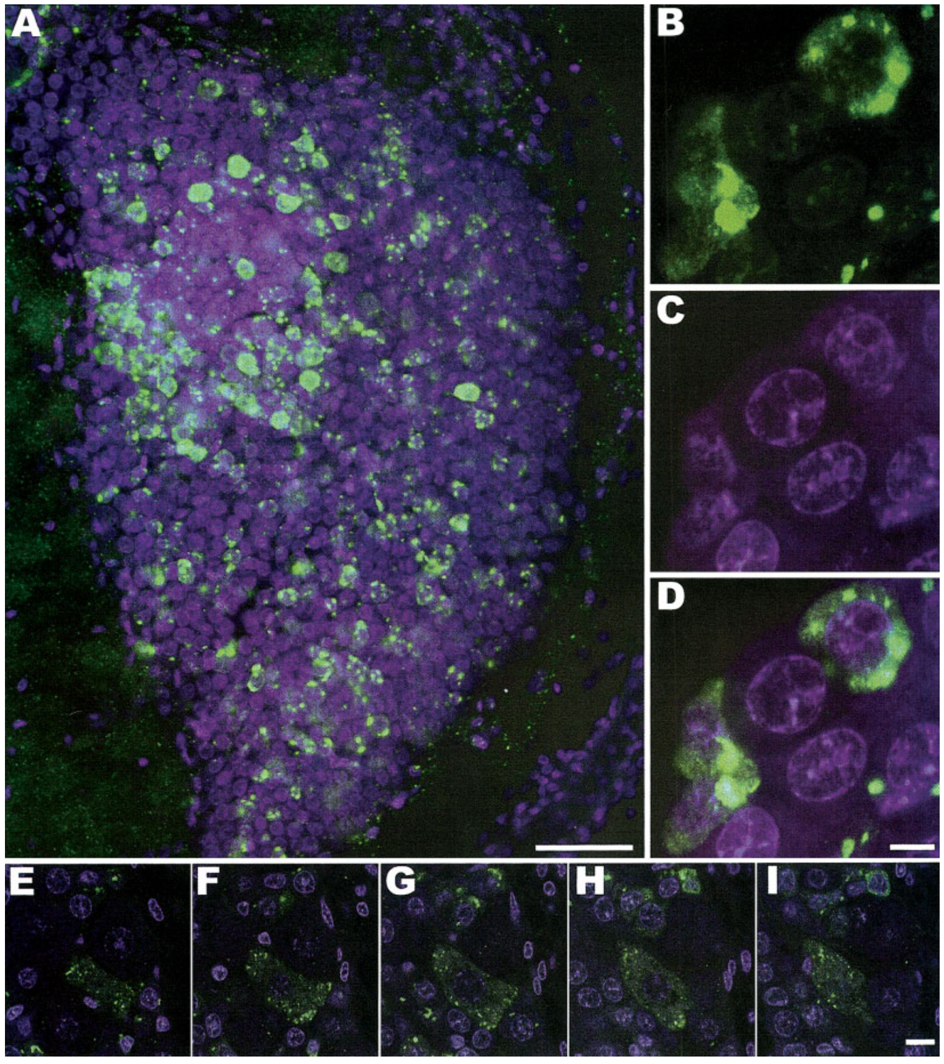
Receptor immunostaining identifies candidate locations
Immunocytochemistry uses antibodies to locate a target molecule in cells. Spitzer and colleagues mapped a putative crustacean type-1 serotonin receptor, designated 5-HT1crust, with fluorescence microscopy. They compared receptor labeling with serotonin labeling to see where the two signals overlap in the tissue.
Receptor-associated puncta occurred around neuronal somata, which are cell bodies, and within their cytoplasm. In cluster 10 brain cells, optical sections separated the labeled material from nuclear staining. Antibody preabsorption controls reduced the specific labeling pattern, which confirms that the antibody is detecting the target.
The map identifies candidate locations where the receptor could act on serotonergic signals. Each labeled region is compared with the nuclear counterstain and with the control sections. The labeling pattern is then used to point to the cells most likely to carry the receptor.
Spitzer et al. (2005), Fig. 3(A–I). Putative type-1 receptor labeling and nuclear counterstaining.
Spitzer et al. (2005)
27
Notes:
• Immunocytochemistry uses antibodies to locate a target molecule in cells. Spitzer and colleagues mapped a putative crustacean type-1 serotonin receptor, designated 5-HT1crust, with fluorescence microscopy and compared receptor labeling with serotonin labeling.
• Receptor-associated puncta occurred around neuronal somata (cell bodies) and within their cytoplasm. In cluster 10 brain cells, optical sections separated labeled material from nuclear staining; source panels include 5-µm and 50-µm calibration. Antibody preabsorption controls reduced the specific labeling pattern.
– A soma is a neuron’s cell body, and a punctum is a small localized region of label. Antibody preabsorption tests whether binding depends on the recognized antigen. Even specific molecular recognition does not measure receptor coupling, current flow or the consequence of activating the labeled cell.
• The map identifies candidate locations for serotonergic signaling, but immunoreactivity is not a direct measurement of receptor activation. Cytoplasmic labeling may reflect intracellular receptor pools as well as membrane-associated protein. Neither proximity to serotonin-containing fibers nor a bright signal establishes that the receptor is necessary for social dominance or a particular escape response.
References:
Nadja Spitzer; Brian L. Antonsen; Donald H. Edwards (2005). Immunocytochemical mapping and quantification of expression of a putative type 1 serotonin receptor in the crayfish nervous system. The Journal of Comparative Neurology, 484(3): 261-282. https://doi.org/10.1002/cne.20456
Figure: Spitzer et al. (2005), Fig. 3(A–I). Putative type-1 receptor labeling and nuclear counterstaining.
Figure source: https://doi.org/10.1002/cne.20456

Slide 36
A receptor map shows candidate cellular sites
Immunocytochemistry uses antibodies to locate a target molecule in cells. Spitzer and colleagues mapped a putative crustacean type-1 serotonin receptor, designated 5-HT1crust, with fluorescence microscopy, and they compared the receptor labeling with serotonin labeling.
Receptor-associated puncta occurred around neuronal cell bodies and within their cytoplasm. In cluster 10 brain cells, optical sections separated the labeled material from nuclear staining. Antibody preabsorption controls reduced the specific labeling pattern, which confirms that the antibody detects its target.
The map identifies candidate locations where the receptor could act on serotonergic signals. Each labeled region is compared with the nuclear counterstain and with the control sections, which points to the cells most likely to carry the receptor.
Spitzer et al. (2005), Fig. 3(A–I). Putative type-1 receptor labeling and nuclear counterstaining.
Spitzer et al. (2005)
27a
Notes:
• A receptor map points to candidate cells.
• Method.
– Antibodies locate the receptor in tissue.
– Serotonin labeling is compared with it.
• Labeling.
– Puncta surround cell bodies and fill cytoplasm.
– Nuclear staining is separated optically.
• Controls.
– Preabsorption reduced the specific labeling.
– The antibody detects its target.
• Meaning.
– Candidate cells are identified by the map.
– Controls keep the reading specific.
• Source values.
– The published recordings and measurements come from the original paper.
– Each result is reported with the condition used in the source.
• Why the measure matters.
– The result separates the measured property from the mechanism that produces it.
– The comparison stays within the same animals, ganglia or cells.
• Interpretation.
– Each result is read within the preparation and social history that produced it.
– The claim is restricted to the measured animals and conditions.
• Context.
– The parent figure shows the measurement that the paragraphs describe.
– Each claim is tied to the recordings of the original study.
• Method.
– The measurements follow the methods described in the original paper.
– Each value is kept with the condition under which it was measured.
References:
Nadja Spitzer; Brian L. Antonsen; Donald H. Edwards (2005). Immunocytochemical mapping and quantification of expression of a putative type 1 serotonin receptor in the crayfish nervous system. The Journal of Comparative Neurology, 484(3): 261-282. https://doi.org/10.1002/cne.20456

Slide 37
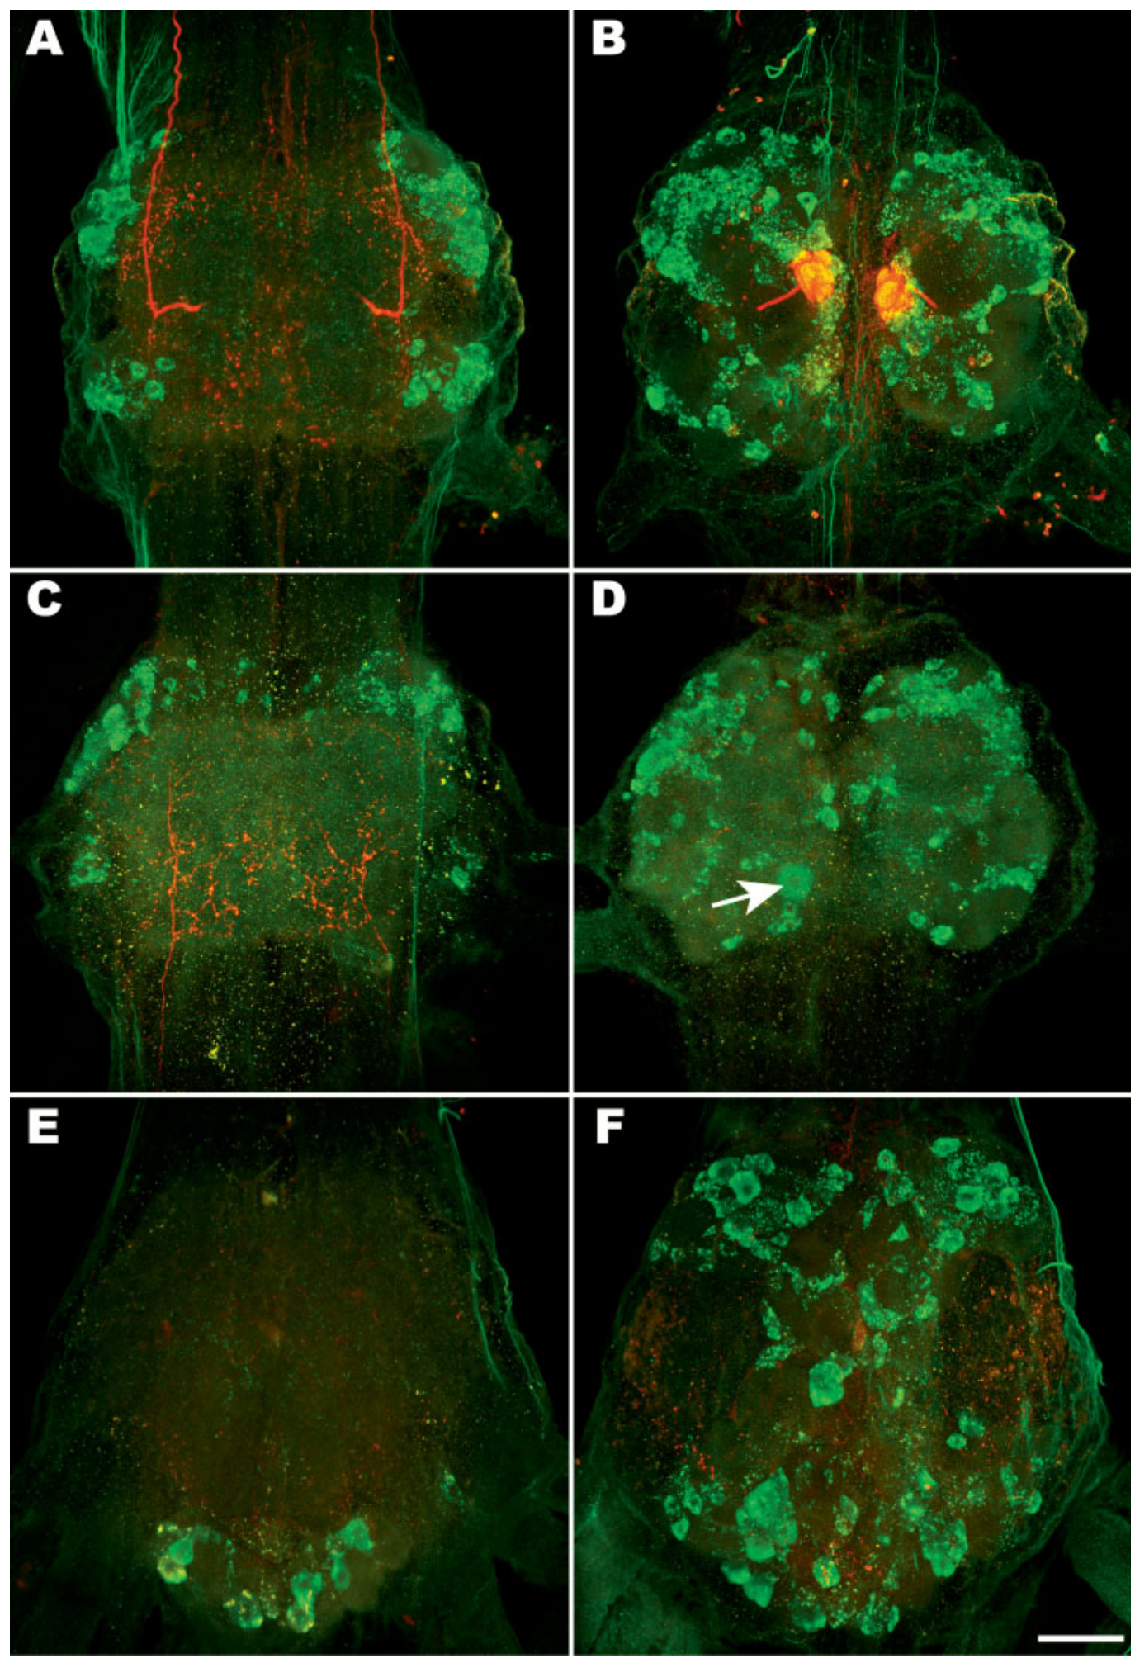
The mapped type-1 receptor was not detected on LG
Spitzer and colleagues found putative type-1 receptor immunoreactivity in cell clusters and in neuropil throughout the abdominal ganglia. Neuropil is a region rich in neuronal processes and synaptic connections. The labeling shows segmental concentrations of cell bodies and their connections across the nerve cord.
The mapped receptor was not detected on LG or on the thin serotonin-containing fiber associated with it. Independent dye filling and serotonin immunostaining by Yeh and colleagues identified LG axons and nearby serotonergic varicosities. The two anatomical maps are compared side by side in the same nerve cord.
The receptor map and the LG map therefore identify different cellular sites. The receptor is present in nearby neuropil, while LG itself is identified by the dye fill. Each label is kept with its own anatomical reference. Each label is kept with its own anatomical reference, so the two maps are never merged.
Spitzer et al. (2005), Fig. 9(A–F). Receptor labeling across abdominal ganglia.
Yeh et al. (1997), Fig. 13(A,C). Dye-filled LG neurons and nearby serotonin-immunoreactive fibers.
Spitzer et al. (2005); Yeh et al. (1997)
28
Notes:
• Spitzer and colleagues found putative type-1 receptor immunoreactivity in cell clusters and neuropil throughout abdominal ganglia, segmental concentrations of neuronal cell bodies and their connections. Neuropil is a region rich in neuronal processes and synaptic connections. The terminal ganglion retained the pattern expected from its fused organization.
• The mapped receptor was not detected on LG or on the thin serotonin-containing fiber associated with it. Independent dye filling and serotonin immunostaining by Yeh and colleagues identified LG axons and nearby serotonergic varicosities; these measurements concern different molecular targets.
– A varicosity is a swelling along a neuronal process that can contain release machinery. Detecting serotonin near an LG axon establishes anatomical proximity, while failing to label a receptor establishes only the result of that receptor assay. Combining the two does not identify the functional postsynaptic target.
• Consequently, the receptor map does not confirm a direct type-1 receptor mechanism in LG. Receptor-mediated modulation could occur elsewhere in the circuit, or another subtype could be involved. Failure to detect staining also has sensitivity limits, so it should not be treated as proof that every type-1-related action is impossible in the giant neuron.
References:
Nadja Spitzer; Brian L. Antonsen; Donald H. Edwards (2005). Immunocytochemical mapping and quantification of expression of a putative type 1 serotonin receptor in the crayfish nervous system. The Journal of Comparative Neurology, 484(3): 261-282. https://doi.org/10.1002/cne.20456
Shih-Rung Yeh; Barbara E. Musolf; Donald H. Edwards (1997). Neuronal Adaptations to Changes in the Social Dominance Status of Crayfish. The Journal of Neuroscience, 17(2): 697-708. https://doi.org/10.1523/jneurosci.17-02-00697.1997
Figure: Spitzer et al. (2005), Fig. 9(A–F). Receptor labeling across abdominal ganglia.
Figure source: https://doi.org/10.1002/cne.20456
Figure: Yeh et al. (1997), Fig. 13(A,C). Dye-filled LG neurons and nearby serotonin-immunoreactive fibers.
Figure source: https://doi.org/10.1523/jneurosci.17-02-00697.1997

Slide 38
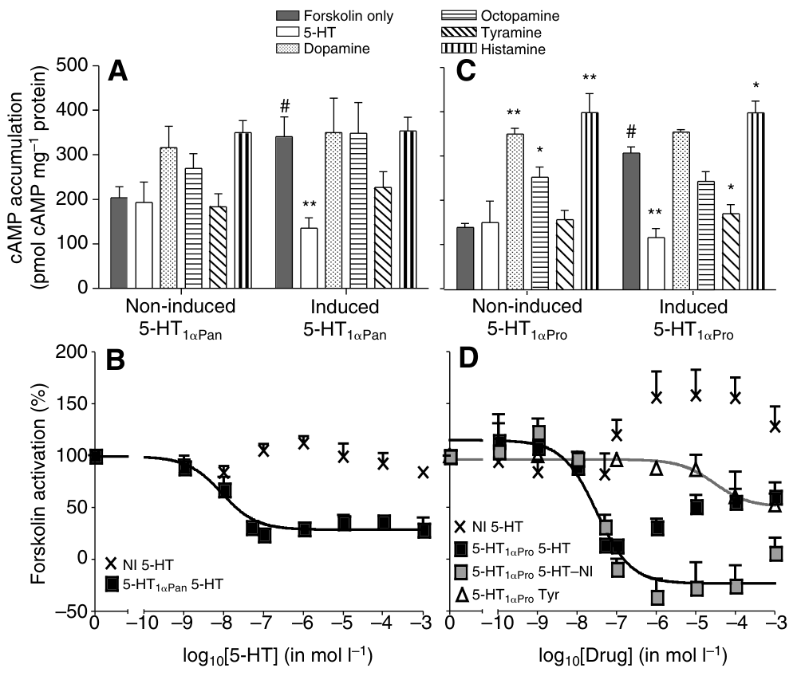
A cloned type-1 receptor suppresses cAMP accumulation
A G-protein-coupled receptor transmits extracellular ligand binding into intracellular signaling through a G protein. A ligand is a molecule that binds to a receptor. Cyclic AMP, or cAMP, is an intracellular second messenger that relays receptor activation to cellular processes. Spitzer and colleagues expressed cloned crustacean receptors in mammalian cells.
Activating crayfish 5-HT1α reduced forskolin-stimulated cAMP accumulation. Forskolin activates adenylyl cyclase, the enzyme that produces cAMP. After accounting for background cellular responses, serotonin's half-maximal effective concentration was measured for this receptor, giving a quantitative value for each receptor type.
The cloned receptor therefore suppresses cAMP through a defined pathway. The cell-culture result is compared with the mapped receptor in the nerve cord. Each receptor's signaling is described by its own response curve.
Spitzer et al. (2008), Fig. 5(A–D). Cloned type-1 receptors suppress stimulated cAMP accumulation.
Spitzer et al. (2005), Fig. 3(A–I). Putative type-1 receptor labeling and nuclear counterstaining.
Spitzer et al. (2008); Spitzer et al. (2005)
29
Notes:
• A G-protein-coupled receptor transmits extracellular ligand binding into intracellular signaling through a G protein. A ligand is a receptor-binding molecule. Cyclic AMP (cAMP) is an intracellular second messenger, a molecule relaying receptor activation to cellular processes. Spitzer and colleagues expressed cloned crustacean receptors in mammalian cells.
• Activating crayfish 5-HT1α reduced forskolin-stimulated cAMP accumulation. Forskolin activates adenylyl cyclase, the enzyme producing cAMP. After accounting for background cellular responses, serotonin’s half-maximal effective concentration was about 31 nM. Non-induced cells controlled for responses unrelated to the introduced receptor.
– The half-maximal effective concentration is the concentration producing half of the measured maximal response under the assay conditions. It is a functional potency measure rather than a direct binding affinity. The cellular host can itself respond at high serotonin concentrations, which is why the matched non-induced comparison is necessary.
• These assays establish receptor-dependent signaling consistent with cyclase inhibition by Gi/o, an inhibitory G-protein family. They do not establish that this receptor is located on LG or mediates its social-history-dependent inhibition. A second-messenger decrease in an expression system is distinct from a demonstrated behavioral action in crayfish.
References:
Nadja Spitzer; Donald H. Edwards; Deborah J. Baro (2008). Conservation of structure, signaling and pharmacology between two serotonin receptor subtypes from decapod crustaceans, Panulirus interruptus and Procambarus clarkii. Journal of Experimental Biology, 211(1): 92-105. https://doi.org/10.1242/jeb.012450
Nadja Spitzer; Brian L. Antonsen; Donald H. Edwards (2005). Immunocytochemical mapping and quantification of expression of a putative type 1 serotonin receptor in the crayfish nervous system. The Journal of Comparative Neurology, 484(3): 261-282. https://doi.org/10.1002/cne.20456
Figure: Spitzer et al. (2008), Fig. 5(A–D). Cloned type-1 receptors suppress stimulated cAMP accumulation.
Figure source: https://doi.org/10.1242/jeb.012450
Figure: Spitzer et al. (2005), Fig. 3(A–I). Putative type-1 receptor labeling and nuclear counterstaining.
Figure source: https://doi.org/10.1002/cne.20456

Slide 39
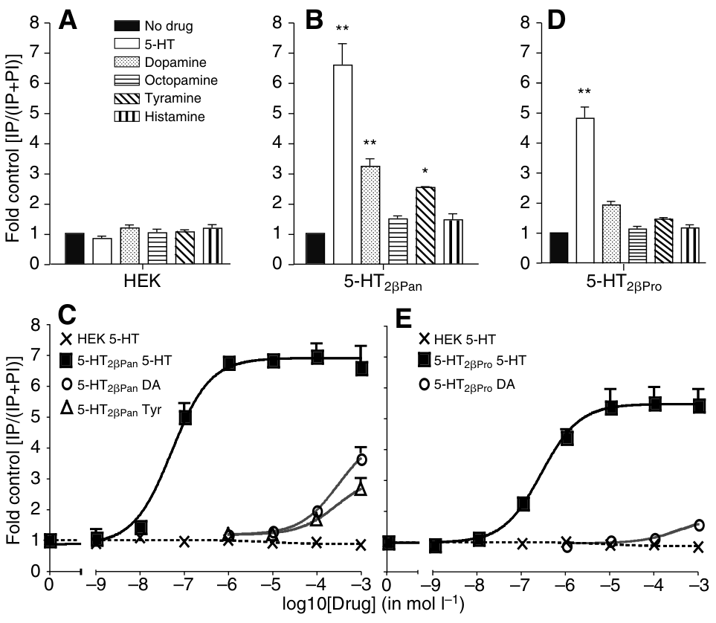
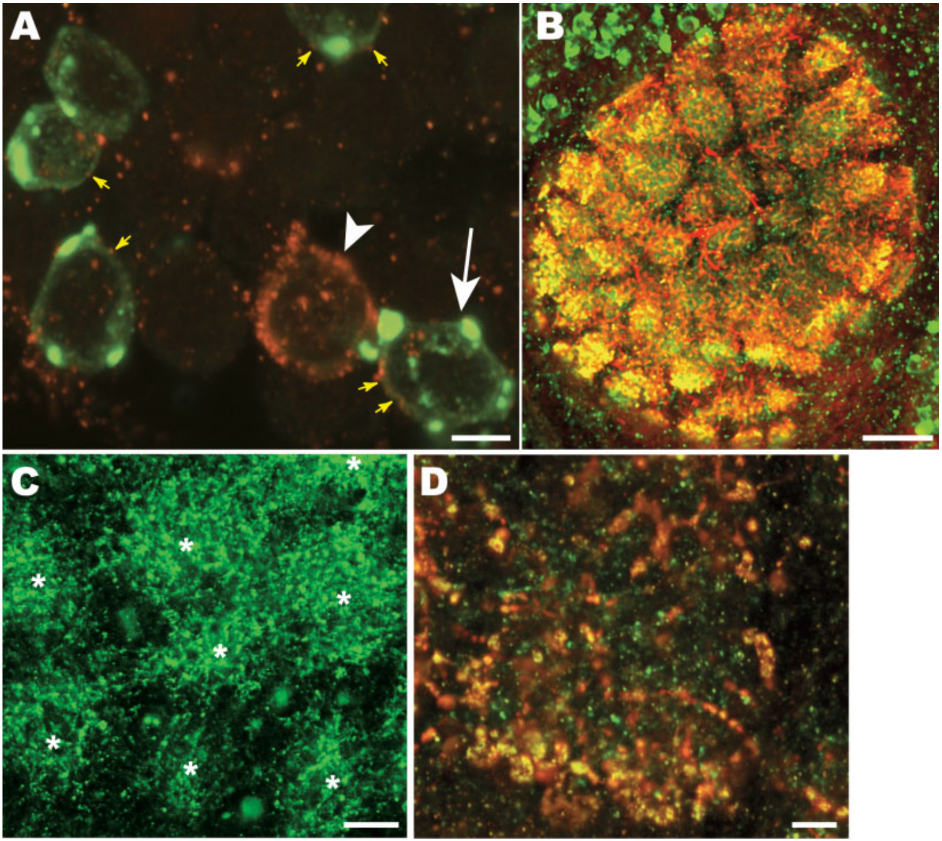
A cloned type-2 receptor activates a different messenger
Spitzer and colleagues expressed the crayfish 5-HT2β receptor in HEK cells, a mammalian cell line used to test an introduced protein. They measured inositol phosphates, which are intracellular products generated when phospholipase C cleaves membrane phosphoinositides. This measurement reports the activity of a different signaling route from cAMP.
Cells that expressed the type-2 receptor raised inositol-phosphate levels when serotonin was added, with a half-maximal concentration near 270 nM. Mock-transfected cells that lacked the receptor gave no comparable signal. Among the other monoamines tested, only a few reached measurable activity, and most needed far higher concentrations.
The assay therefore links the type-2 receptor to a distinct messenger pathway. Serotonin is the most potent ligand among those tested. Each response is compared with the matched control cells, which keeps the receptor effect separate from the cell's background.
Spitzer et al. (2008), Fig. 4(A–E). Cloned type-2 receptors activate inositol-phosphate signaling.
Spitzer et al. (2005), Fig. 4(A–D). Receptor and serotonin labeling in brain neuropil.
Spitzer et al. (2008); Spitzer et al. (2005)
30
Notes:
• Spitzer and colleagues expressed the crayfish 5-HT2β receptor in HEK cells, a mammalian cell line used to test an introduced protein. They measured inositol phosphates, intracellular products generated when phospholipase C cleaves membrane phosphoinositides, a lipid family.
• Serotonin increased inositol-phosphate accumulation in receptor-expressing cells, with a half-maximal effective concentration near 270 nM. Matched non-transfected cells did not produce the same receptor-associated response. Other tested monoamines required much higher concentrations or had little activity.
– A heterologous system expresses a protein outside its original tissue. It permits controlled comparison of receptor responses while leaving the native network absent. Receptor classification, molecular coupling and behavioral function are therefore distinct levels of evidence that require different experiments.
• The assay separates two cloned serotonin receptors by their signaling and pharmacology. It supports a type-2-associated phosphoinositide pathway, but does not assign that cloned receptor to LG facilitation. Published receptor staining supplies anatomical context for candidate signaling sites; the molecular subtype producing the cAMP-dependent giant-neuron effect remains a separate question.
References:
Nadja Spitzer; Donald H. Edwards; Deborah J. Baro (2008). Conservation of structure, signaling and pharmacology between two serotonin receptor subtypes from decapod crustaceans, Panulirus interruptus and Procambarus clarkii. Journal of Experimental Biology, 211(1): 92-105. https://doi.org/10.1242/jeb.012450
Nadja Spitzer; Brian L. Antonsen; Donald H. Edwards (2005). Immunocytochemical mapping and quantification of expression of a putative type 1 serotonin receptor in the crayfish nervous system. The Journal of Comparative Neurology, 484(3): 261-282. https://doi.org/10.1002/cne.20456
Figure: Spitzer et al. (2008), Fig. 4(A–E). Cloned type-2 receptors activate inositol-phosphate signaling.
Figure source: https://doi.org/10.1242/jeb.012450
Figure: Spitzer et al. (2005), Fig. 4(A–D). Receptor and serotonin labeling in brain neuropil.
Figure source: https://doi.org/10.1002/cne.20456

Slide 40
Cloned type-2 receptors activate inositol signaling
Spitzer and colleagues expressed the crayfish 5-HT2β receptor in HEK cells, a mammalian cell line used to test an introduced protein. They measured inositol phosphates, intracellular products generated when phospholipase C cleaves membrane phosphoinositides.
Serotonin increased inositol-phosphate accumulation in receptor-expressing cells, with a half-maximal effective concentration near 270 nM. Matched non-transfected cells produced no comparable response. Other tested monoamines required much higher concentrations or had little activity.
The assay links the type-2 receptor to a messenger pathway that is distinct from cAMP. Serotonin is the most potent ligand among those tested, and each response is compared with the matched control cells. The receptor signal is read as its own pathway, separate from the cAMP route.
Spitzer et al. (2008), Fig. 4(A–E). Cloned type-2 receptors activate inositol-phosphate signaling.
Spitzer et al. (2005), Fig. 4(A–D). Receptor and serotonin labeling in brain neuropil.
Spitzer et al. (2008)
30a
Notes:
• The type-2 receptor activates a distinct messenger.
• Expression.
– The receptor was expressed in HEK cells.
– HEK cells are a mammalian test line.
• Readout.
– Inositol phosphates were measured.
– They come from phospholipase C.
• Potency.
– Serotonin was the most potent ligand.
– Its half-maximal concentration was near 270 nM.
• Meaning.
– Signaling differs from the type-1 cAMP route.
– Controls keep the effect specific.
• Source values.
– The published recordings and measurements come from the original paper.
– Each result is reported with the condition used in the source.
• Why the measure matters.
– The result separates the measured property from the mechanism that produces it.
– The comparison stays within the same animals, ganglia or cells.
• Interpretation.
– Each result is read within the preparation and social history that produced it.
– The claim is restricted to the measured animals and conditions.
• Context.
– The parent figure shows the measurement that the paragraphs describe.
– Each claim is tied to the recordings of the original study.
• Method.
– The measurements follow the methods described in the original paper.
– Each value is kept with the condition under which it was measured.
References:
Nadja Spitzer; Donald H. Edwards; Deborah J. Baro (2008). Conservation of structure, signaling and pharmacology between two serotonin receptor subtypes from decapod crustaceans, Panulirus interruptus and Procambarus clarkii. Journal of Experimental Biology, 211(1): 92-105. https://doi.org/10.1242/jeb.012450

Slide 41
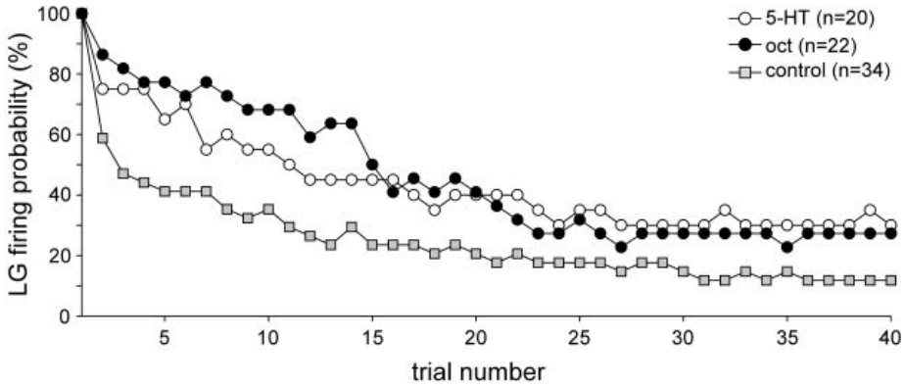
Repeated input habituates the LG response
Habituation is a decline in response during repeated stimulation. Araki and colleagues tested isolated abdominal nerve cords from adult crayfish, stimulating sensory roots while recording whether LG produced an action potential. The preparation preserves the local sensory pathway while removing ongoing social interaction.
Just-suprathreshold shocks were delivered every 5 s. In control saline, response probability fell rapidly, with roughly half the preparations failing within the first five trials. Pretreatment with 10 µM serotonin or octopamine slowed this decline, so the amines kept the response available for longer.
The amines increased the number of trials that LG could follow before habituating. Each preparation is tracked trial by trial, so the rate of decline is compared directly with the saline control. The result shows a modulatory effect on the repeated response itself.
Araki et al. (2005), Fig. 1. Amines slow loss of LG firing during 5-s stimulation intervals.
Yeh et al. (1997), Fig. 13(A,C). Dye-filled LG neurons and nearby serotonin-immunoreactive fibers.
Araki et al. (2005); Yeh et al. (1997)
31
Notes:
• Habituation is a decline in response during repeated stimulation. Araki and colleagues tested isolated abdominal nerve cords from adult crayfish, stimulating sensory roots while recording whether LG produced an action potential. The preparation preserved the local sensory pathway while removing ongoing social interaction.
• Just-suprathreshold shocks were delivered every 5 s. In control saline, response probability fell rapidly, with roughly half the preparations failing within the first five trials. Pretreatment with 10 µM serotonin or octopamine slowed the decline.
– The investigators required five consecutive failures to classify a preparation as habituated. This criterion avoids treating one intermittent failure as a lasting loss of response. The declining probability across preparations is not a firing-rate recording from one neuron and should not be interpreted as spikes per second.
• The amines increased the number of stimuli needed to lose reliable LG firing. This establishes modulation of repeated-input responsiveness, rather than a measured change in free-animal retreat or fighting. Because the initial stimulus was selected near threshold, a modest increase in sensory gain can strongly affect whether a repeated trial still recruits the giant neuron.
References:
Makoto Araki; Toshiki Nagayama; Jordanna Sprayberry (2005). Cyclic AMP Mediates Serotonin-Induced Synaptic Enhancement of Lateral Giant Interneuron of the Crayfish. Journal of Neurophysiology, 94(4): 2644-2652. https://doi.org/10.1152/jn.00502.2005
Shih-Rung Yeh; Barbara E. Musolf; Donald H. Edwards (1997). Neuronal Adaptations to Changes in the Social Dominance Status of Crayfish. The Journal of Neuroscience, 17(2): 697-708. https://doi.org/10.1523/jneurosci.17-02-00697.1997
Figure: Araki et al. (2005), Fig. 1. Amines slow loss of LG firing during 5-s stimulation intervals.
Figure source: https://doi.org/10.1152/jn.00502.2005
Figure: Yeh et al. (1997), Fig. 13(A,C). Dye-filled LG neurons and nearby serotonin-immunoreactive fibers.
Figure source: https://doi.org/10.1523/jneurosci.17-02-00697.1997

Slide 42
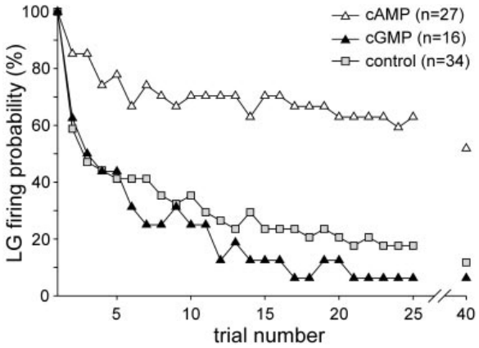
A cAMP analogue reproduces resistance to habituation
A second-messenger analogue is a compound designed to activate or mimic part of an intracellular signaling pathway. Araki and colleagues compared cyclic-nucleotide analogues after establishing a near-threshold stimulus to the LG sensory pathway. The analogues provide a way to test whether cAMP itself can change habituation.
Combining 50 µM CPT-cAMP with 50 µM IBMX slowed habituation during 5 s stimulus intervals. IBMX inhibits phosphodiesterases, the enzymes that break down cyclic nucleotides. A 100 µM cGMP analogue did not reproduce this effect, because the control curve declined more rapidly than the cAMP-treated curve.
The comparison supports a cAMP-sensitive facilitator of the repeated response. Each analogue is compared with the same control curve, so the cAMP effect is isolated from the other cyclic nucleotide. The pattern points to cAMP as the messenger that slows habituation.
Araki et al. (2005), Fig. 2. cAMP and cGMP analogue effects on LG habituation.
Yeh et al. (1997), Fig. 13(A,C). Dye-filled LG neurons and nearby serotonin-immunoreactive fibers.
Araki et al. (2005); Yeh et al. (1997)
32
Notes:
• A second-messenger analogue is a compound designed to activate or mimic part of an intracellular signaling pathway. Araki and colleagues compared cyclic-nucleotide analogues after establishing a near-threshold stimulus to the LG sensory pathway.
• Combining 50 µM CPT-cAMP with 50 µM IBMX slowed habituation during 5-s stimulus intervals. IBMX inhibits phosphodiesterases, enzymes that break down cyclic nucleotides. A 100 µM cGMP analogue did not reproduce this effect; the control curve declined more rapidly than the cAMP-treated curve.
– Cyclic GMP is another cyclic-nucleotide messenger with signaling actions distinct from cAMP. An analogue mimicking facilitation supplies evidence of pathway sufficiency under treatment conditions. Locating the action requires a more selective intervention than exposing the entire ganglion to the compound.
• The comparison supports a cAMP-sensitive facilitatory mechanism and distinguishes it from the tested cGMP manipulation. Bath delivery can act on several cells within the ganglion, so this experiment alone does not place the relevant second messenger inside LG or establish that serotonin normally produces exactly the same intracellular concentration.
References:
Makoto Araki; Toshiki Nagayama; Jordanna Sprayberry (2005). Cyclic AMP Mediates Serotonin-Induced Synaptic Enhancement of Lateral Giant Interneuron of the Crayfish. Journal of Neurophysiology, 94(4): 2644-2652. https://doi.org/10.1152/jn.00502.2005
Shih-Rung Yeh; Barbara E. Musolf; Donald H. Edwards (1997). Neuronal Adaptations to Changes in the Social Dominance Status of Crayfish. The Journal of Neuroscience, 17(2): 697-708. https://doi.org/10.1523/jneurosci.17-02-00697.1997
Figure: Araki et al. (2005), Fig. 2. cAMP and cGMP analogue effects on LG habituation.
Figure source: https://doi.org/10.1152/jn.00502.2005
Figure: Yeh et al. (1997), Fig. 13(A,C). Dye-filled LG neurons and nearby serotonin-immunoreactive fibers.
Figure source: https://doi.org/10.1523/jneurosci.17-02-00697.1997

Slide 43
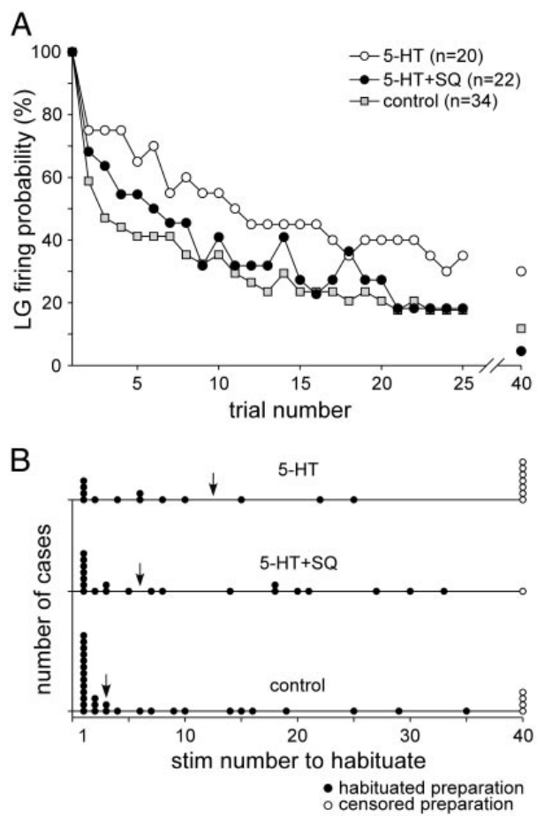
Cyclase inhibition removes serotonin’s facilitatory effect
Adenylyl cyclase produces cAMP, so inhibiting this enzyme tests whether serotonin's facilitation requires cyclic-nucleotide synthesis. Araki and colleagues pretreated isolated abdominal preparations with 100 µM SQ22536 before adding 10 µM serotonin. The inhibitor was applied before the drug in every preparation.
With serotonin alone, the median stimulus number before habituation was 12.5, compared with 3 in controls. With cyclase inhibition and serotonin together, the median was 6, and later response loss approached the control pattern. The inhibitor alone did not appreciably change the initial shock threshold.
This pharmacological interaction supports a serotonin action that runs through cAMP synthesis. Blocking the enzyme removes most of the extra resistance to habituation that serotonin produces. Each preparation is compared with its own control to show how much of the effect the cyclase block removes.
Araki et al. (2005), Fig. 3(A–B). Cyclase inhibition reduces serotonin-dependent facilitation.
Yeh et al. (1997), Fig. 13(A,C). Dye-filled LG neurons and nearby serotonin-immunoreactive fibers.
Araki et al. (2005); Yeh et al. (1997)
33
Notes:
• Adenylyl cyclase produces cAMP, so inhibiting this enzyme tests whether serotonin’s facilitation requires cyclic-nucleotide synthesis. Araki and colleagues pretreated isolated abdominal preparations with 100 µM SQ22536 before adding 10 µM serotonin.
• With serotonin alone, the median stimulus number before habituation was 12.5, compared with 3 in controls. With cyclase inhibition and serotonin, the median was 6 and later response loss approached the control pattern. The inhibitor alone did not appreciably change the initial shock threshold.
– A pathway inhibitor tests dependence rather than simple correlation. Its interpretation still depends on drug specificity and on the controls for baseline responsiveness. In this study, octopamine facilitation persisted during cyclase inhibition, indicating that similar behavioral-direction effects can arise through different intracellular mechanisms.
• This pharmacological interaction supports a cyclase-dependent component of serotonin-induced facilitation. The preserved initial threshold reduces an explanation based on general failure of the preparation. It does not identify the upstream receptor or prove that the same pathway accounts for serotonergic inhibition in experienced subordinates, which was not the preparation tested.
References:
Makoto Araki; Toshiki Nagayama; Jordanna Sprayberry (2005). Cyclic AMP Mediates Serotonin-Induced Synaptic Enhancement of Lateral Giant Interneuron of the Crayfish. Journal of Neurophysiology, 94(4): 2644-2652. https://doi.org/10.1152/jn.00502.2005
Shih-Rung Yeh; Barbara E. Musolf; Donald H. Edwards (1997). Neuronal Adaptations to Changes in the Social Dominance Status of Crayfish. The Journal of Neuroscience, 17(2): 697-708. https://doi.org/10.1523/jneurosci.17-02-00697.1997
Figure: Araki et al. (2005), Fig. 3(A–B). Cyclase inhibition reduces serotonin-dependent facilitation.
Figure source: https://doi.org/10.1152/jn.00502.2005
Figure: Yeh et al. (1997), Fig. 13(A,C). Dye-filled LG neurons and nearby serotonin-immunoreactive fibers.
Figure source: https://doi.org/10.1523/jneurosci.17-02-00697.1997

Slide 44
A cyclase block removes serotonin's facilitation
Adenylyl cyclase produces cAMP, so inhibiting this enzyme tests whether serotonin's facilitation requires cyclic-nucleotide synthesis. Araki and colleagues pretreated isolated abdominal preparations with 100 µM SQ22536 before adding 10 µM serotonin, applying the inhibitor before the drug in every preparation.
With serotonin alone, the median stimulus number before habituation was 12.5, compared with 3 in controls. With cyclase inhibition and serotonin together, the median was 6, and later response loss approached the control pattern. The inhibitor alone did not change the initial shock threshold.
This interaction supports a serotonin action that runs through cAMP synthesis. Blocking the enzyme removes most of the extra resistance to habituation that serotonin produces, and each preparation is compared with its own control.
Araki et al. (2005), Fig. 3(A–B). Cyclase inhibition reduces serotonin-dependent facilitation.
Yeh et al. (1997), Fig. 13(A,C). Dye-filled LG neurons and nearby serotonin-immunoreactive fibers.
Araki et al. (2005)
33a
Notes:
• The cyclase block removes serotonin's effect on habituation.
• Inhibitor.
– SQ22536 blocks adenylyl cyclase.
– It was applied before serotonin.
• Serotonin alone.
– The median stimulus number was 12.5.
– Controls had a median of 3.
• With block.
– The median fell to 6 with inhibition.
– Response loss approached the control pattern.
• Meaning.
– Serotonin's effect requires cAMP synthesis.
– Each preparation is compared with its control.
• Source values.
– The published recordings and measurements come from the original paper.
– Each result is reported with the condition used in the source.
• Why the measure matters.
– The result separates the measured property from the mechanism that produces it.
– The comparison stays within the same animals, ganglia or cells.
• Interpretation.
– Each result is read within the preparation and social history that produced it.
– The claim is restricted to the measured animals and conditions.
• Context.
– The parent figure shows the measurement that the paragraphs describe.
– Each claim is tied to the recordings of the original study.
• Method.
– The measurements follow the methods described in the original paper.
– Each value is kept with the condition under which it was measured.
References:
Makoto Araki; Toshiki Nagayama; Jordanna Sprayberry (2005). Cyclic AMP Mediates Serotonin-Induced Synaptic Enhancement of Lateral Giant Interneuron of the Crayfish. Journal of Neurophysiology, 94(4): 2644-2652. https://doi.org/10.1152/jn.00502.2005

Slide 45
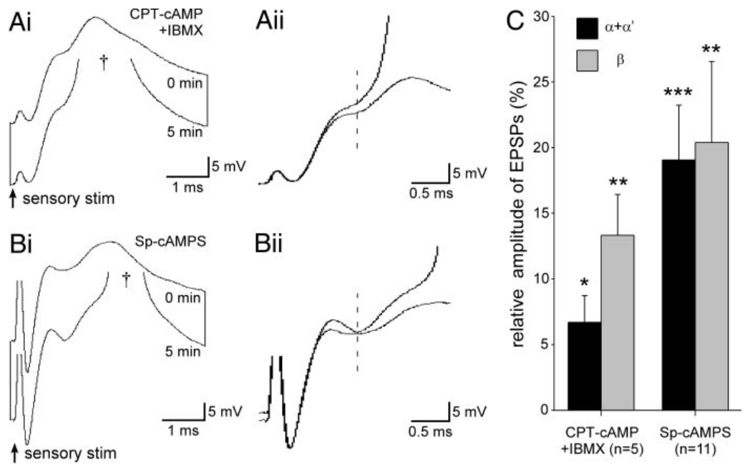
Intracellular cAMP action can enhance LG directly
Bath application delivers a drug to the whole preparation, so the effect is averaged across the whole preparation. Araki and colleagues therefore injected Sp-cAMPS, a phosphodiesterase-resistant cAMP analogue, directly into the recorded LG neuron while testing sensory responses. The electrode solution contained 50 mM analogue.
After 5 min of injection, early EPSPs increased by about 19%, and later EPSPs increased by about 20%. Current injection through an electrode containing only the carrier solution controlled for the injection procedure. The analogue also caused a small depolarization of approximately 5.4 mV.
Direct intracellular action supports a cAMP effect inside LG itself. The change is measured in the same neuron before and after the injection. Each EPSP is compared with the control electrode, so the effect is attributed to the analogue.
Araki et al. (2005), Fig. 6(A–C). Bath and intracellular cAMP analogue effects on LG.
Yeh et al. (1997), Fig. 13(A,C). Dye-filled LG neurons and nearby serotonin-immunoreactive fibers.
Araki et al. (2005); Yeh et al. (1997)
34
Notes:
• Bath application cannot locate a messenger’s cellular target. Araki and colleagues therefore injected Sp-cAMPS, a phosphodiesterase-resistant cAMP analogue, directly into the recorded LG neuron while testing sensory responses. The electrode solution contained 50 mM analogue.
• After 5 min of injection, early EPSPs increased by about 19% and later EPSPs by about 20%. Current injection through an electrode containing only the carrier solution controlled for the injection procedure. The analogue also caused a small depolarization, approximately 5.4 mV.
– Iontophoretic injection uses electrical current to move the charged compound out of an electrode into the cell. The carrier-current control tests whether the current itself accounts for the voltage change. Increasing both response components is consistent with a postsynaptic contribution, although it does not exclude additional effects elsewhere during normal serotonin exposure.
• Direct intracellular action supports LG as a site capable of cAMP-dependent sensory enhancement. The electrode concentration is not a measured final intracellular concentration. The result does not identify a particular kinase, channel or receptor, nor establish that intracellular cAMP enhancement alone is sufficient to change social dominance in a freely behaving animal.
References:
Makoto Araki; Toshiki Nagayama; Jordanna Sprayberry (2005). Cyclic AMP Mediates Serotonin-Induced Synaptic Enhancement of Lateral Giant Interneuron of the Crayfish. Journal of Neurophysiology, 94(4): 2644-2652. https://doi.org/10.1152/jn.00502.2005
Shih-Rung Yeh; Barbara E. Musolf; Donald H. Edwards (1997). Neuronal Adaptations to Changes in the Social Dominance Status of Crayfish. The Journal of Neuroscience, 17(2): 697-708. https://doi.org/10.1523/jneurosci.17-02-00697.1997
Figure: Araki et al. (2005), Fig. 6(A–C). Bath and intracellular cAMP analogue effects on LG.
Figure source: https://doi.org/10.1152/jn.00502.2005
Figure: Yeh et al. (1997), Fig. 13(A,C). Dye-filled LG neurons and nearby serotonin-immunoreactive fibers.
Figure source: https://doi.org/10.1523/jneurosci.17-02-00697.1997

Slide 46
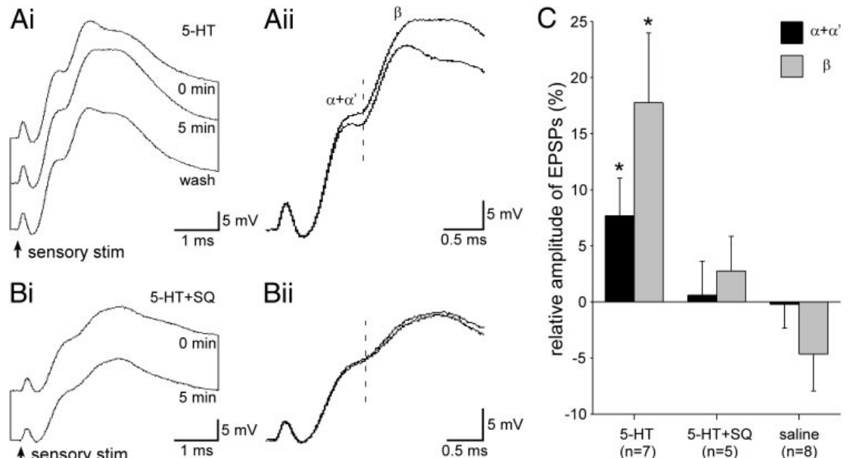
Serotonin enhances EPSPs without a large voltage shift
Araki and colleagues compared sensory EPSPs before and after 5 min of 5 µM serotonin in isolated abdominal nerve cords. Their early response combined direct electrical and chemical contributions, whereas the later response included an intervening sensory interneuron. The two components are therefore measured separately.
Early EPSPs grew by roughly 8% and later EPSPs by roughly 18% after serotonin. Resting LG voltage barely moved, whereas cyclase inhibition removed most of both increases. Saline controls showed no comparable gain, and washout recovered part of the original response.
Facilitation therefore does not need a large tonic depolarization to occur. The enhancement appears in the synaptic responses themselves. Each EPSP is compared with its matched baseline and with the cyclase-inhibited preparation.
Araki et al. (2005), Fig. 4(A–C). Sensory EPSPs during serotonin and cyclase-inhibitor treatment.
Yeh et al. (1997), Fig. 13(A,C). Dye-filled LG neurons and nearby serotonin-immunoreactive fibers.
Araki et al. (2005); Yeh et al. (1997)
35
Notes:
• Araki and colleagues compared sensory EPSPs before and after 5 min of 5 µM serotonin in isolated abdominal nerve cords. Their early response combined direct electrical and chemical contributions; the later response included an intervening sensory interneuron.
• The early EPSP increased by about 8% and the later EPSP by about 18%. Resting LG voltage changed little, while cyclase inhibition largely removed both increases. Saline controls did not produce the same enhancement, and washout partially restored the original response.
– The early component in this preparation was measured as α plus α-prime because its direct electrical and chemical peaks were difficult to separate in time. It should not be equated without qualification with a purely electrical α measurement in another preparation. Preserving these component definitions avoids assigning every effect to one synapse.
• Facilitation therefore need not be explained by a large tonic depolarization. Its relation to cyclase activity supports second-messenger modulation of sensory responsiveness. These measurements identify a physiological effect and a pharmacological dependence, but they do not determine which membrane conductance or electrical-synapse property carries the enhancement at the molecular level.
References:
Makoto Araki; Toshiki Nagayama; Jordanna Sprayberry (2005). Cyclic AMP Mediates Serotonin-Induced Synaptic Enhancement of Lateral Giant Interneuron of the Crayfish. Journal of Neurophysiology, 94(4): 2644-2652. https://doi.org/10.1152/jn.00502.2005
Shih-Rung Yeh; Barbara E. Musolf; Donald H. Edwards (1997). Neuronal Adaptations to Changes in the Social Dominance Status of Crayfish. The Journal of Neuroscience, 17(2): 697-708. https://doi.org/10.1523/jneurosci.17-02-00697.1997
Figure: Araki et al. (2005), Fig. 4(A–C). Sensory EPSPs during serotonin and cyclase-inhibitor treatment.
Figure source: https://doi.org/10.1152/jn.00502.2005
Figure: Yeh et al. (1997), Fig. 13(A,C). Dye-filled LG neurons and nearby serotonin-immunoreactive fibers.
Figure source: https://doi.org/10.1523/jneurosci.17-02-00697.1997

Slide 47
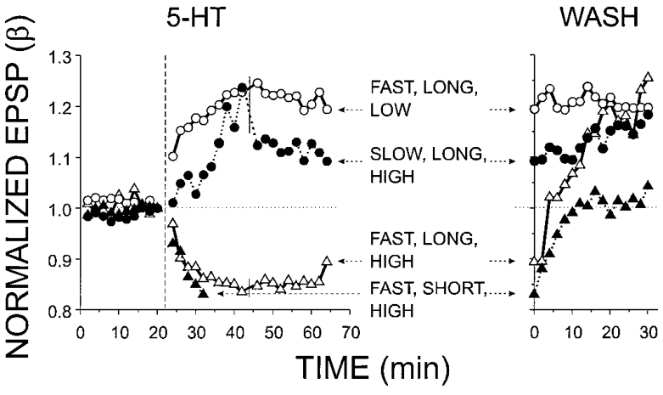
Long exposure leaves facilitation after serotonin removal
Exposure duration changes the persistence of serotonergic modulation. Teshiba and colleagues compared brief application, of approximately 10 min, with longer exposures near 45 min. They then followed sensory EPSPs during a saline washout, so each exposure length is tracked through recovery.
Brief high exposure produced inhibition that reversed relatively rapidly. Longer exposure could be followed by persistent facilitation, even after an inhibitory phase during rapid high delivery. Facilitated responses remained above baseline during the 30 min wash comparison and could persist for hours.
The result separates the immediate sign of the response during drug presence from its sign after the drug is removed. Duration and washout are therefore read as two separate features of the same exposure. Each recording is compared with the baseline of its own preparation.
Teshiba et al. (2001), Fig. 2. Exposure-dependent changes during application and washout.
Yeh et al. (1997), Fig. 13(A,C). Dye-filled LG neurons and nearby serotonin-immunoreactive fibers.
Teshiba et al. (2001); Yeh et al. (1997)
36
Notes:
• Exposure duration changes the persistence of serotonergic modulation. Teshiba and colleagues compared brief application, approximately 10 min, with longer exposures near 45 min, then followed sensory EPSPs during saline washout.
• Brief high exposure produced inhibition that reversed relatively rapidly. Longer exposure could be followed by persistent facilitation, even after an inhibitory phase during rapid high delivery. Facilitated responses remained above baseline during the 30-min wash comparison and could persist for hours.
– Removing serotonin from the bathing solution ends further delivery without forcing every downstream cellular process to return immediately to baseline. The source distinguished short-lived inhibition from more persistent facilitation. Persistence after wash therefore provides information about the time course of modulation rather than a direct assay of retained receptor occupancy.
• The result separates the immediate sign during drug presence from the state retained after exposure. It supports intracellular processes with different activation and decay rates. Proposed interacting signaling cascades can account for these time courses, but the recordings alone do not identify their molecular components or establish an enduring memory of dominance from a single serotonin treatment.
References:
Terri Teshiba; Ashkan Shamsian; Bahram Yashar; Shih-Rung Yeh; Donald H. Edwards; Franklin B. Krasne (2001). Dual and Opposing Modulatory Effects of Serotonin on Crayfish Lateral Giant Escape Command Neurons. The Journal of Neuroscience, 21(12): 4523-4529. https://doi.org/10.1523/jneurosci.21-12-04523.2001
Shih-Rung Yeh; Barbara E. Musolf; Donald H. Edwards (1997). Neuronal Adaptations to Changes in the Social Dominance Status of Crayfish. The Journal of Neuroscience, 17(2): 697-708. https://doi.org/10.1523/jneurosci.17-02-00697.1997
Figure: Teshiba et al. (2001), Fig. 2. Exposure-dependent changes during application and washout.
Figure source: https://doi.org/10.1523/jneurosci.21-12-04523.2001
Figure: Yeh et al. (1997), Fig. 13(A,C). Dye-filled LG neurons and nearby serotonin-immunoreactive fibers.
Figure source: https://doi.org/10.1523/jneurosci.17-02-00697.1997

Slide 48
Long exposure leaves facilitation after washout
Exposure duration changes how long serotonergic modulation persists. Teshiba and colleagues compared brief application, of approximately 10 min, with longer exposures near 45 min. They then followed sensory EPSPs during a saline washout, so each exposure length is tracked through recovery.
Brief high exposure produced inhibition that reversed relatively rapidly. Longer exposure was followed by persistent facilitation, even after an inhibitory phase during rapid high delivery. Facilitated responses remained above baseline during the 30 min wash comparison and could persist for hours.
The result separates the immediate sign of the response during drug presence from its sign after the drug is removed. Each recording is compared with the baseline of its own preparation, so duration and washout are read as separate features.
Teshiba et al. (2001), Fig. 2. Exposure-dependent changes during application and washout.
Yeh et al. (1997), Fig. 13(A,C). Dye-filled LG neurons and nearby serotonin-immunoreactive fibers.
Teshiba et al. (2001)
36a
Notes:
• Long exposure leaves facilitation after washout.
• Duration.
– Brief exposure lasted about 10 min.
– Longer exposure lasted near 45 min.
• Brief exposure.
– Inhibition reversed relatively rapidly.
– Recovery was fast.
• Long exposure.
– Facilitation persisted after the inhibitory phase.
– It remained above baseline.
• Meaning.
– Sign during presence differs from sign after removal.
– Each preparation is its own baseline.
• Source values.
– The published recordings and measurements come from the original paper.
– Each result is reported with the condition used in the source.
• Why the measure matters.
– The result separates the measured property from the mechanism that produces it.
– The comparison stays within the same animals, ganglia or cells.
• Interpretation.
– Each result is read within the preparation and social history that produced it.
– The claim is restricted to the measured animals and conditions.
• Context.
– The parent figure shows the measurement that the paragraphs describe.
– Each claim is tied to the recordings of the original study.
• Method.
– The measurements follow the methods described in the original paper.
– Each value is kept with the condition under which it was measured.
References:
Terri Teshiba; Ashkan Shamsian; Bahram Yashar; Shih-Rung Yeh; Donald H. Edwards; Franklin B. Krasne (2001). Dual and Opposing Modulatory Effects of Serotonin on Crayfish Lateral Giant Escape Command Neurons. The Journal of Neuroscience, 21(12): 4523-4529. https://doi.org/10.1523/jneurosci.21-12-04523.2001

Slide 49
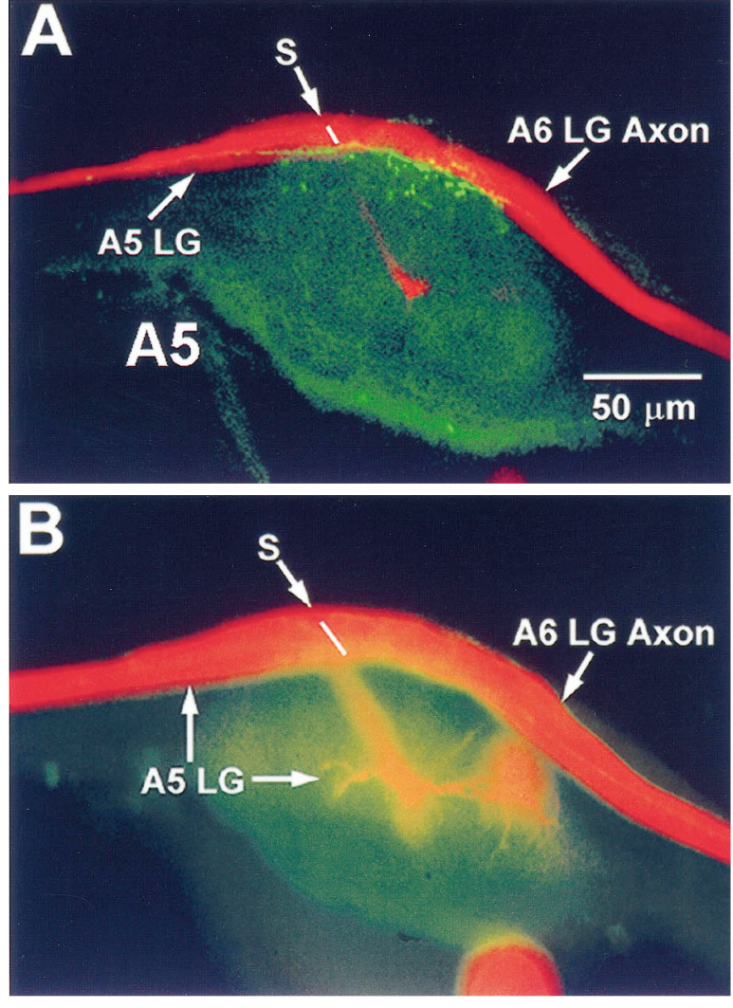
Serotonin-containing fibers lie near LG axons
Yeh and colleagues combined dye filling of identified LG neurons with serotonin immunostaining. Varicosities are swellings along neuronal processes that may take part in transmitter release. Confocal imaging related the labeled fibers to the known giant-neuron anatomy, so each fiber is placed relative to LG.
In abdominal ganglion A5, serotonin-immunoreactive terminals lay near LG axons around the septate junction, the connection between successive segmental giant axons. The source includes a 50 µm scale bar. Similar labeling was associated with proximal portions of the terminal-ganglion LG neurons.
This anatomical proximity suggests a route by which serotonergic terminals could reach LG. The close positions are read alongside the physiological results. Each terminal is located on the same map as the LG axon it lies beside.
Yeh et al. (1997), Fig. 13(A–B). LG axons and nearby serotonin labeling in abdominal ganglion A5.
Yeh et al. (1997)
37
Notes:
• Yeh and colleagues combined dye filling of identified LG neurons with serotonin immunostaining. Varicosities are swellings along neuronal processes that may participate in transmitter release. Confocal imaging related labeled fibers to the known giant-neuron anatomy.
• In abdominal ganglion A5, serotonin-immunoreactive terminals lay near LG axons around the septate junction, the connection between successive segmental giant axons. The source includes a 50-µm scale bar. Similar labeling was associated with proximal portions of the terminal-ganglion LG neurons.
– The serotonin signal is immunoreactivity, not a measurement of transmitter released during fighting. A labeled swelling next to an axon may affect that axon, an adjacent neuron or another target. The anatomical map constrains possible arrangements without deciding which arrangement generates the measured modulation.
• This anatomical proximity supplies candidate sites for local modulation, but it does not prove release onto LG or identify a functional receptor there. Sparse labeling near distal LG dendrites also leaves circulating serotonin as a possible influence. Local and humoral explanations require functional tests beyond the spatial association.
References:
Shih-Rung Yeh; Barbara E. Musolf; Donald H. Edwards (1997). Neuronal Adaptations to Changes in the Social Dominance Status of Crayfish. The Journal of Neuroscience, 17(2): 697-708. https://doi.org/10.1523/jneurosci.17-02-00697.1997
Figure: Yeh et al. (1997), Fig. 13(A–B). LG axons and nearby serotonin labeling in abdominal ganglion A5.
Figure source: https://doi.org/10.1523/jneurosci.17-02-00697.1997

Slide 50
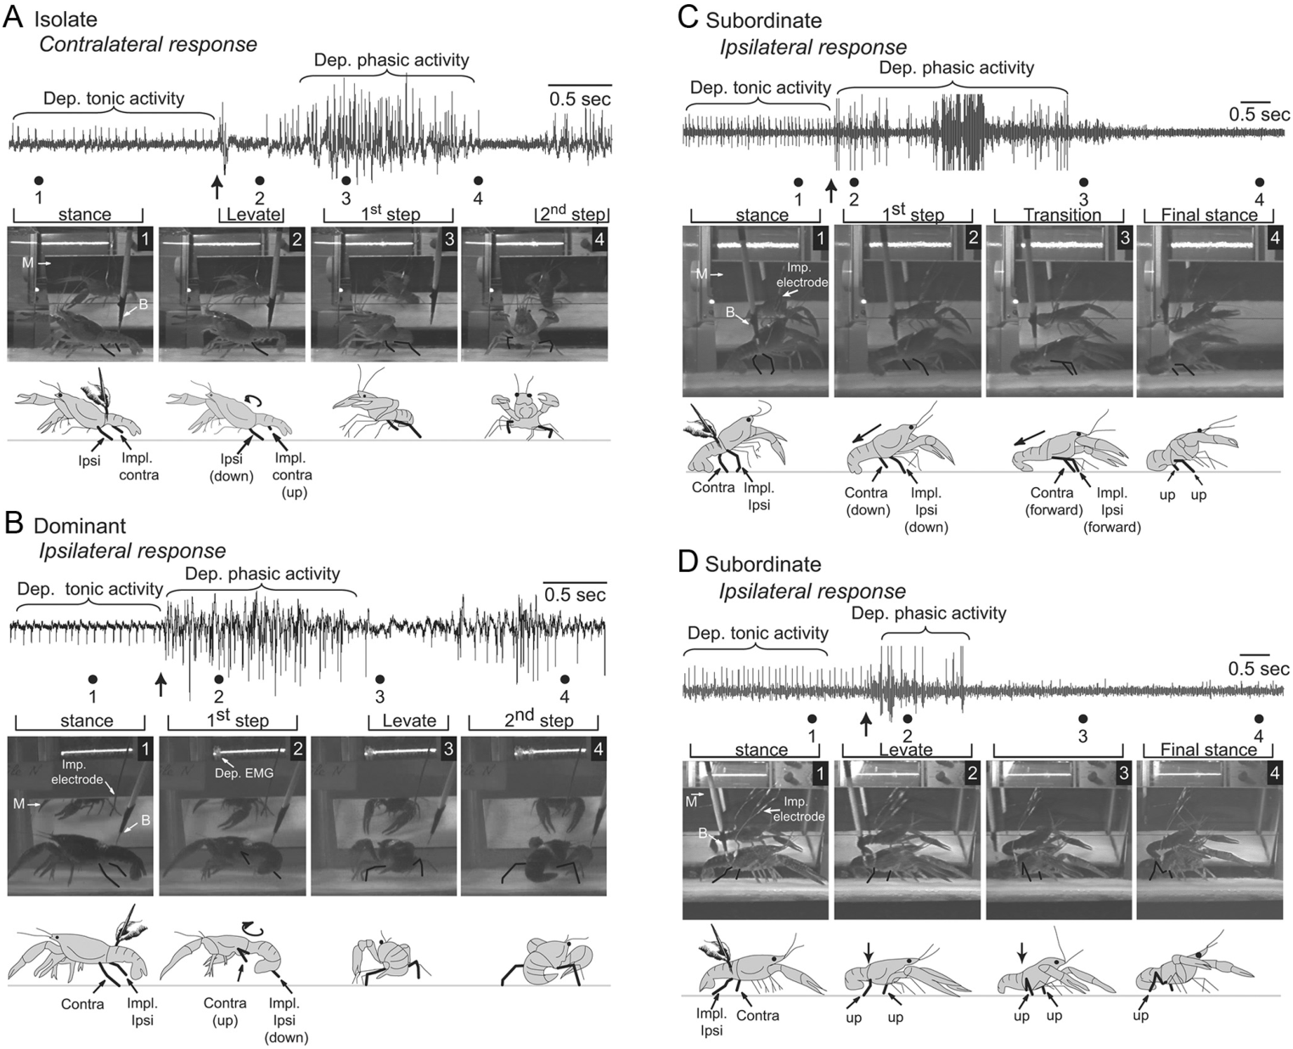
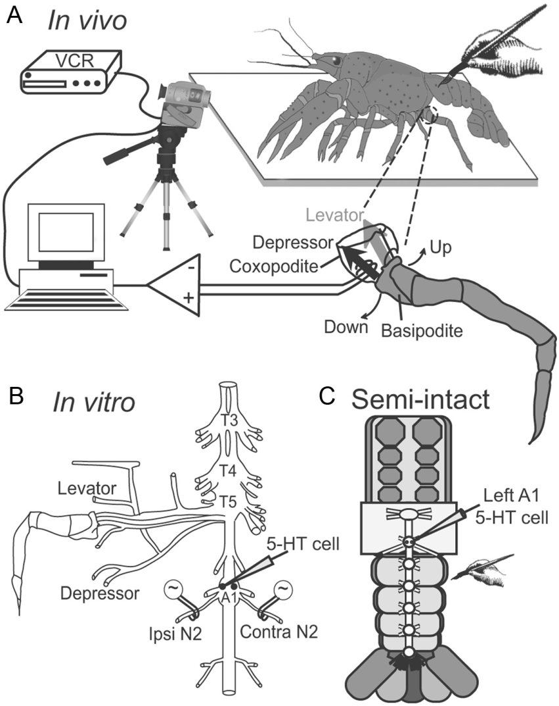
Social rank changes orientation to an unexpected touch
Social modulation extends beyond giant escape. Issa and colleagues tested adult crayfish after isolation or at least two weeks of paired housing. They brushed fringe hairs on one side of the anterior abdomen while recording walking-leg muscle activity, so the tactile input is held constant across animals.
Isolates and dominants turned toward the touched side and lifted their posture. Subordinates pushed backward or bent the abdomen and lowered their bodies. Depressor muscles lower the legs, and their electrical activity tracked these responses across the first 0.6 s.
The same tactile event therefore recruits different motor responses depending on social status. Each animal's response is scored for its direction and its posture change. The muscle record is compared with the behavior in the same animal.
Issa et al. (2012), Fig. 2(A–D). Status-dependent turning, pushing and dropping responses.
Issa et al. (2012), Fig. 1(A–C). Leg depressor anatomy and intact, isolated and semi-intact preparations.
Issa et al. (2012)
38
Notes:
• Social modulation extends beyond giant escape. Issa and colleagues tested adult crayfish after isolation or at least two weeks of paired housing, brushing fringe hairs on one side of the anterior abdomen while recording walking-leg muscle activity.
• Isolates and dominants turned toward the stimulated side and raised their posture. Subordinates instead pushed backward or flexed the abdomen and lowered their posture. Depressor muscles move the legs downward, and their electrical activity differed with these behavioral responses over the first 0.6 s.
– Ipsilateral means on the same side as the stimulus; contralateral means on the opposite side. Turning requires asymmetric leg activation, whereas pushing and lowering can use more symmetric activation. Comparing the two sides distinguishes a change in motor organization from a general reduction in responsiveness.
• The same tactile event therefore recruits different postural actions according to social experience. This is an orienting and walking-leg system, distinct from LG tail-flip escape. Muscle recordings establish a relation between neural output and movement, but do not determine every synaptic connection responsible for selecting the status-dependent response.
References:
Fadi A. Issa; Joanne Drummond; Daniel Cattaert; Donald H. Edwards (2012). Neural Circuit Reconfiguration by Social Status. The Journal of Neuroscience, 32(16): 5638-5645. https://doi.org/10.1523/jneurosci.5668-11.2012
Figure: Issa et al. (2012), Fig. 2(A–D). Status-dependent turning, pushing and dropping responses.
Figure source: https://doi.org/10.1523/jneurosci.5668-11.2012
Figure: Issa et al. (2012), Fig. 1(A–C). Leg depressor anatomy and intact, isolated and semi-intact preparations.
Figure source: https://doi.org/10.1523/jneurosci.5668-11.2012

Slide 51
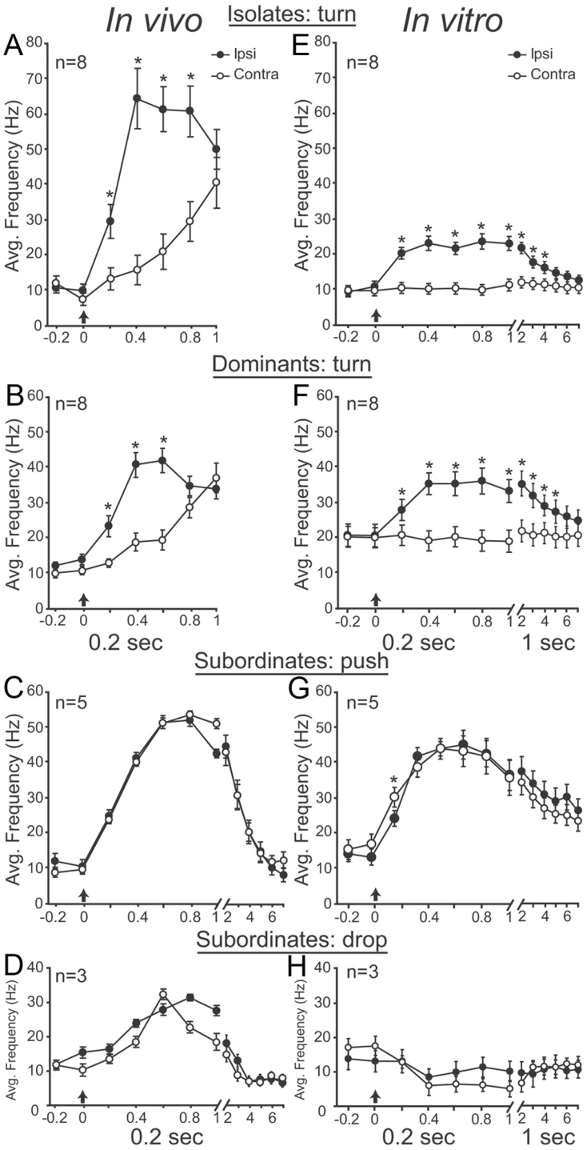
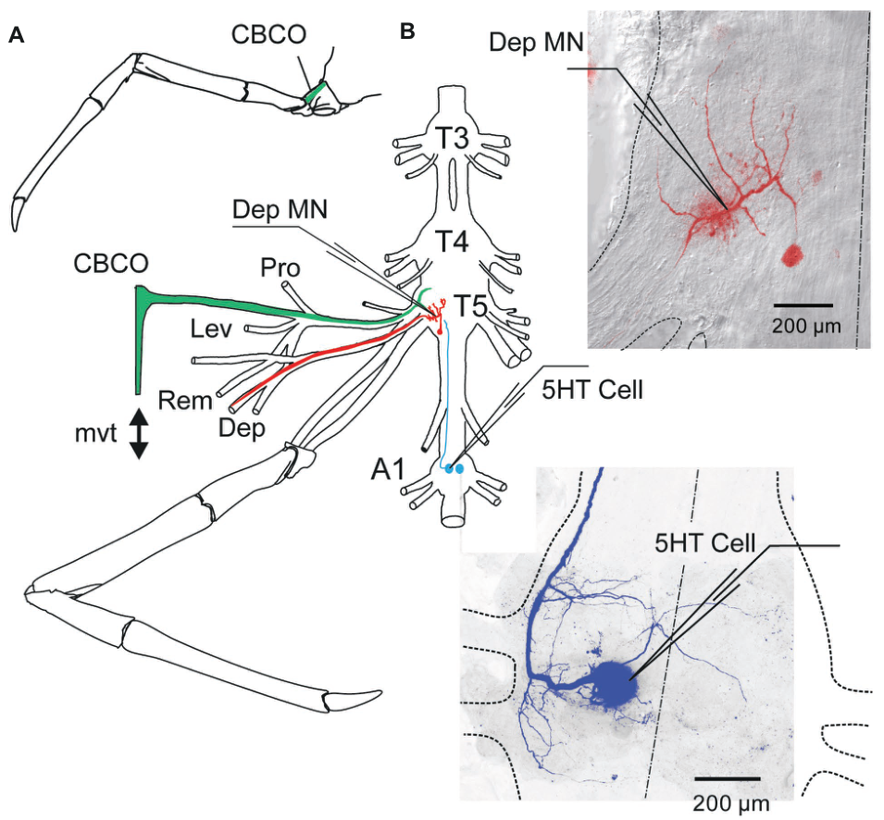
Status-dependent motor organization persists locally
Issa and colleagues recorded intact-animal responses and then isolated thoracic and abdominal ganglia with walking-leg nerves. A ganglion is a local concentration of neuronal cell bodies and their connections. Removing the anterior centers tests whether continuing descending signals are required for the status-related pattern.
Electrical stimulation of an abdominal sensory nerve retained the status-related pattern. Preparations from isolates and dominants favored ipsilateral depressor activity, whereas subordinate preparations produced more symmetric responses. Activity was compared in the same animals before and after circuit isolation.
The status-related organization therefore persists in local circuits after the anterior centers are removed. Each isolated ganglion carries the pattern of its animal's social history. The comparison identifies the local circuit as one site of the status effect.
Bacqué-Cazenave et al. (2019), Fig. 1(A–B). Walking-leg preparation and an identified abdominal serotonin neuron.
Issa et al. (2012), Fig. 3(A–H). Status differences persist in isolated sensorimotor preparations.
Issa et al. (2012); Bacqué-Cazenave et al. (2019)
39
Notes:
• Issa and colleagues recorded intact-animal responses and then isolated thoracic and abdominal ganglia with walking-leg nerves. A ganglion is a local concentration of neuronal cell bodies and their connections. Removing anterior centers tested whether continuing descending signals were required.
• Electrical stimulation of an abdominal sensory nerve retained the status-related pattern. Preparations from isolates and dominants favored ipsilateral depressor activity; subordinate preparations produced more symmetric responses. Activity was compared in the same animals before and after circuit isolation.
– The isolated preparation has no continuing connection to the brain, but it still contains interneurons, sensory inputs and local modulatory cells. Persistence therefore places a maintained difference within the retained tissue. A proposed circuit model can reproduce the pattern without proving that each modeled connection exists biologically.
• The retained difference supports a local functional reconfiguration induced by social experience. It does not show that higher centers were irrelevant when the change originally developed. Nor does it establish that this local walking circuit uses the same receptors or intracellular mechanism that modulate the LG escape command neuron.
References:
Fadi A. Issa; Joanne Drummond; Daniel Cattaert; Donald H. Edwards (2012). Neural Circuit Reconfiguration by Social Status. The Journal of Neuroscience, 32(16): 5638-5645. https://doi.org/10.1523/jneurosci.5668-11.2012
Julien Bacqué-Cazenave; Pascal Fossat; Fadi A. Issa; Donald H. Edwards; Jean Paul Delbecque; Daniel Cattaert (2019). Duality of 5-HT Effects on Crayfish Motoneurons. Frontiers in Physiology, 10: 1280. https://doi.org/10.3389/fphys.2019.01280
Figure: Issa et al. (2012), Fig. 3(A–H). Status differences persist in isolated sensorimotor preparations.
Figure source: https://doi.org/10.1523/jneurosci.5668-11.2012
Figure: Bacqué-Cazenave et al. (2019), Fig. 1(A–B). Walking-leg preparation and an identified abdominal serotonin neuron.
Figure source: https://doi.org/10.3389/fphys.2019.01280

Slide 52
Status persists in isolated ganglia
An isolated ganglion is a local concentration of neuronal cell bodies and their connections, removed from the anterior centers. Issa and colleagues isolated thoracic and abdominal ganglia with walking-leg nerves, so the local circuit can be tested without descending input.
Electrical stimulation of an abdominal sensory nerve retained the status-related pattern. Preparations from isolates and dominants favored ipsilateral depressor activity, whereas subordinate preparations produced more symmetric responses. Each preparation is compared before and after circuit isolation.
The status-related organization therefore persists in local circuits after the anterior centers are removed. Each isolated ganglion carries the pattern of its animal's social history, which identifies the local circuit as one site of the status effect.
Bacqué-Cazenave et al. (2019), Fig. 1(A–B). Walking-leg preparation and an identified abdominal serotonin neuron.
Issa et al. (2012), Fig. 3(A–H). Status differences persist in isolated sensorimotor preparations.
Issa et al. (2012)
39a
Notes:
• The status pattern persists in isolated ganglia.
• Isolation.
– Ganglia were removed with their walking-leg nerves.
– Descending input was excluded.
• Stimulation.
– Abdominal sensory nerve stimulation retained the pattern.
– Status shaped the depressor response.
• Symmetry.
– Subordinates produced more symmetric responses.
– Isolates and dominants favored one side.
• Meaning.
– Local circuits carry the status effect.
– Each ganglion keeps its animal's history.
• Source values.
– The published recordings and measurements come from the original paper.
– Each result is reported with the condition used in the source.
• Why the measure matters.
– The result separates the measured property from the mechanism that produces it.
– The comparison stays within the same animals, ganglia or cells.
• Interpretation.
– Each result is read within the preparation and social history that produced it.
– The claim is restricted to the measured animals and conditions.
• Context.
– The parent figure shows the measurement that the paragraphs describe.
– Each claim is tied to the recordings of the original study.
• Method.
– The measurements follow the methods described in the original paper.
– Each value is kept with the condition under which it was measured.
References:
Fadi A. Issa; Joanne Drummond; Daniel Cattaert; Donald H. Edwards (2012). Neural Circuit Reconfiguration by Social Status. The Journal of Neuroscience, 32(16): 5638-5645. https://doi.org/10.1523/jneurosci.5668-11.2012

Slide 53
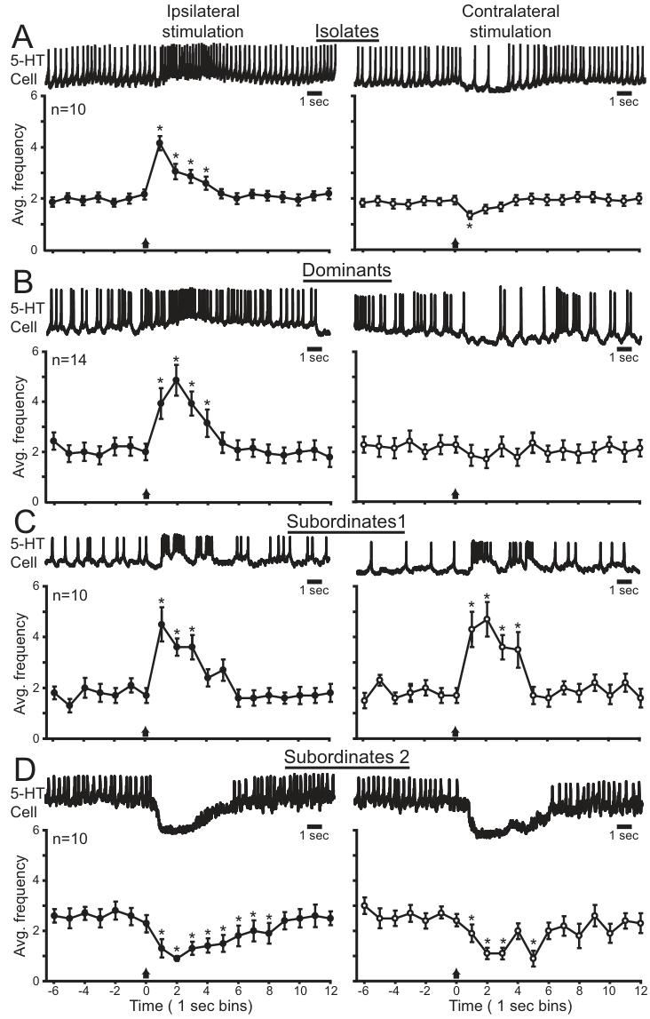
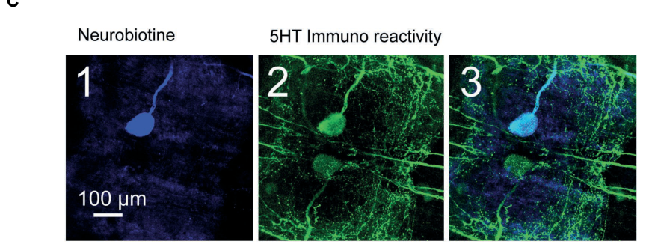
Serotonergic neurons also retain status-dependent input
A serotonergic neuron contains and can signal through serotonin. Issa and colleagues recorded identified serotonin cells in the first abdominal ganglion during unilateral fringe-hair stimulation in semi-intact preparations from animals of known social history. Each cell is linked to the animal's rank.
Cells in isolates and dominants responded differently to ipsilateral and contralateral touch. Subordinate responses were more bilaterally similar, matching the shift in walking-leg organization. Responses were quantified in 1 s time bins around the precisely timed stimulus.
Social status therefore changes how an intrinsic modulatory neuron responds to touch. The serotonin cell carries the same status-dependent organization as the walking-leg circuit. Each cell's response is compared with the matched motor pattern of its animal.
Bacqué-Cazenave et al. (2019), Fig. 2(C1–C3). Neurobiotin-filled cell verified by serotonin immunostaining.
Issa et al. (2012), Fig. 4(A–D). Sensory responses of abdominal serotonin neurons depend on status.
Issa et al. (2012); Bacqué-Cazenave et al. (2019)
40
Notes:
• A serotonergic neuron contains and can signal through serotonin. Issa and colleagues recorded identified serotonin cells in the first abdominal ganglion during unilateral fringe-hair stimulation in semi-intact preparations from animals of known social history.
• Cells in isolates and dominants responded differently to ipsilateral and contralateral touch. Subordinate responses were more bilaterally similar, matching the shift in walking-leg organization. Responses were quantified in 1-s time bins around the precisely timed stimulus.
– The colored cell-identification panels come from Bacqué-Cazenave and colleagues’ separate study, in which a recorded cell was filled with neurobiotin and then tested for serotonin immunoreactivity. They support the anatomy and identification procedure, while the status-dependent physiological evidence comes from Issa and colleagues.
• Social status therefore changes how an intrinsic modulatory neuron participates in sensory processing, not only how downstream neurons respond to applied serotonin. Identification by morphology and serotonin labeling strengthens the cell assignment. The recordings do not directly measure transmitter release or establish that this neuron causes the entire postural response on every trial.
References:
Fadi A. Issa; Joanne Drummond; Daniel Cattaert; Donald H. Edwards (2012). Neural Circuit Reconfiguration by Social Status. The Journal of Neuroscience, 32(16): 5638-5645. https://doi.org/10.1523/jneurosci.5668-11.2012
Julien Bacqué-Cazenave; Pascal Fossat; Fadi A. Issa; Donald H. Edwards; Jean Paul Delbecque; Daniel Cattaert (2019). Duality of 5-HT Effects on Crayfish Motoneurons. Frontiers in Physiology, 10: 1280. https://doi.org/10.3389/fphys.2019.01280
Figure: Issa et al. (2012), Fig. 4(A–D). Sensory responses of abdominal serotonin neurons depend on status.
Figure source: https://doi.org/10.1523/jneurosci.5668-11.2012
Figure: Bacqué-Cazenave et al. (2019), Fig. 2(C1–C3). Neurobiotin-filled cell verified by serotonin immunostaining.
Figure source: https://doi.org/10.3389/fphys.2019.01280

Slide 54
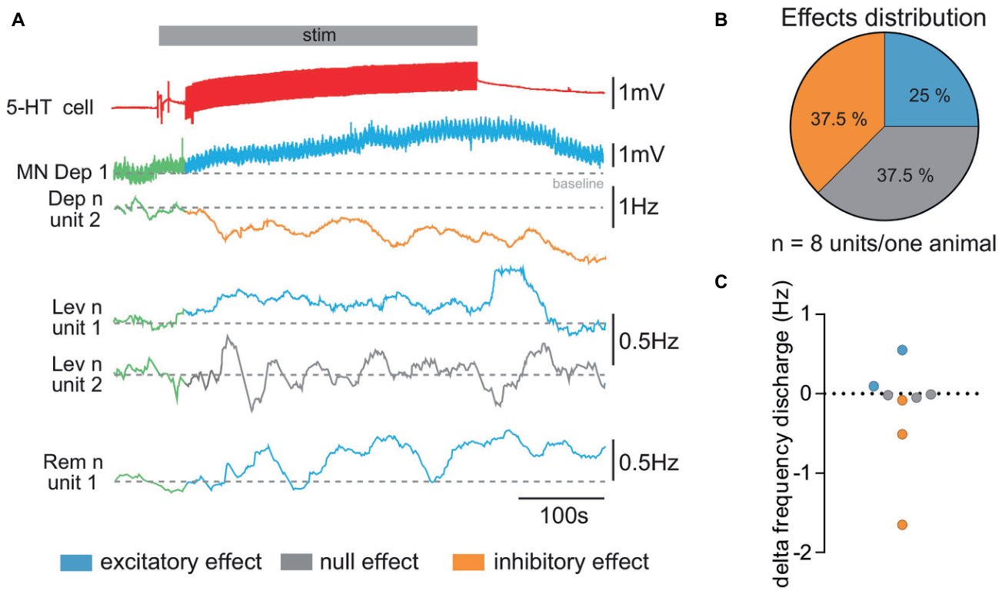
One serotonin neuron produces mixed motor effects
Bacqué-Cazenave and colleagues activated an identified serotonin neuron in the first abdominal ganglion of socially isolated adult crayfish. Intracellular current pulses drove the cell while the researchers recorded individual walking-leg motor units and motor-neuron voltage. The recordings keep each unit's identity across the stimulation.
A 10 s activation produced excitation in some units, inhibition in others and little change in still others. In the same recording, one depressor neuron depolarized while another unit in its nerve reduced its discharge. Changes in the average nerve activity could conceal these opposing effects.
Activation of an endogenous serotonin neuron can therefore push different motor units in opposite directions. The population average hides this split, so each unit is followed on its own. Each motor-unit response is compared with its baseline in the same recording.
Bacqué-Cazenave et al. (2019), Fig. 3(A–C). One serotonin neuron changes different motor units in opposite directions.
Bacqué-Cazenave et al. (2019), Fig. 1(A–B). Walking-leg preparation and an identified abdominal serotonin neuron.
Bacqué-Cazenave et al. (2019)
41
Notes:
• Bacqué-Cazenave and colleagues activated an identified serotonin neuron in the first abdominal ganglion of socially isolated adult crayfish. Intracellular current pulses drove the cell while the researchers recorded individual walking-leg motor units and motor-neuron voltage.
• A 10-s activation produced excitation in some units, inhibition in others and little change in others. In the same recording, one depressor neuron depolarized while another unit in its nerve reduced its discharge. Changes in the average nerve activity could conceal these opposing effects.
– A motor unit is identified here by a distinguishable discharge in the recorded motor nerve. Summing the activity across units can hide simultaneous excitation and inhibition. The intracellular recording and the nerve-unit recording therefore provide information that an average whole-nerve response would lose.
• Activation of an endogenous modulatory cell therefore does not impose one uniform sign on its targets. The result extends beyond experiments applying serotonin to a bath. It concerns the walking-leg network in isolated animals and does not prove that the same neuron generates status-dependent LG inhibition or controls the decision to retreat during fighting.
References:
Julien Bacqué-Cazenave; Pascal Fossat; Fadi A. Issa; Donald H. Edwards; Jean Paul Delbecque; Daniel Cattaert (2019). Duality of 5-HT Effects on Crayfish Motoneurons. Frontiers in Physiology, 10: 1280. https://doi.org/10.3389/fphys.2019.01280
Figure: Bacqué-Cazenave et al. (2019), Fig. 3(A–C). One serotonin neuron changes different motor units in opposite directions.
Figure source: https://doi.org/10.3389/fphys.2019.01280
Figure: Bacqué-Cazenave et al. (2019), Fig. 1(A–B). Walking-leg preparation and an identified abdominal serotonin neuron.
Figure source: https://doi.org/10.3389/fphys.2019.01280

Slide 55
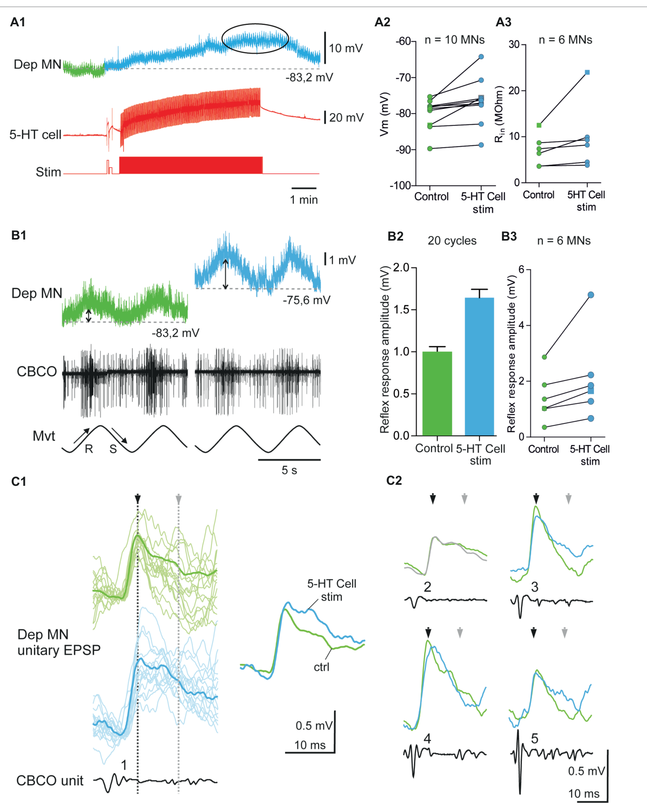
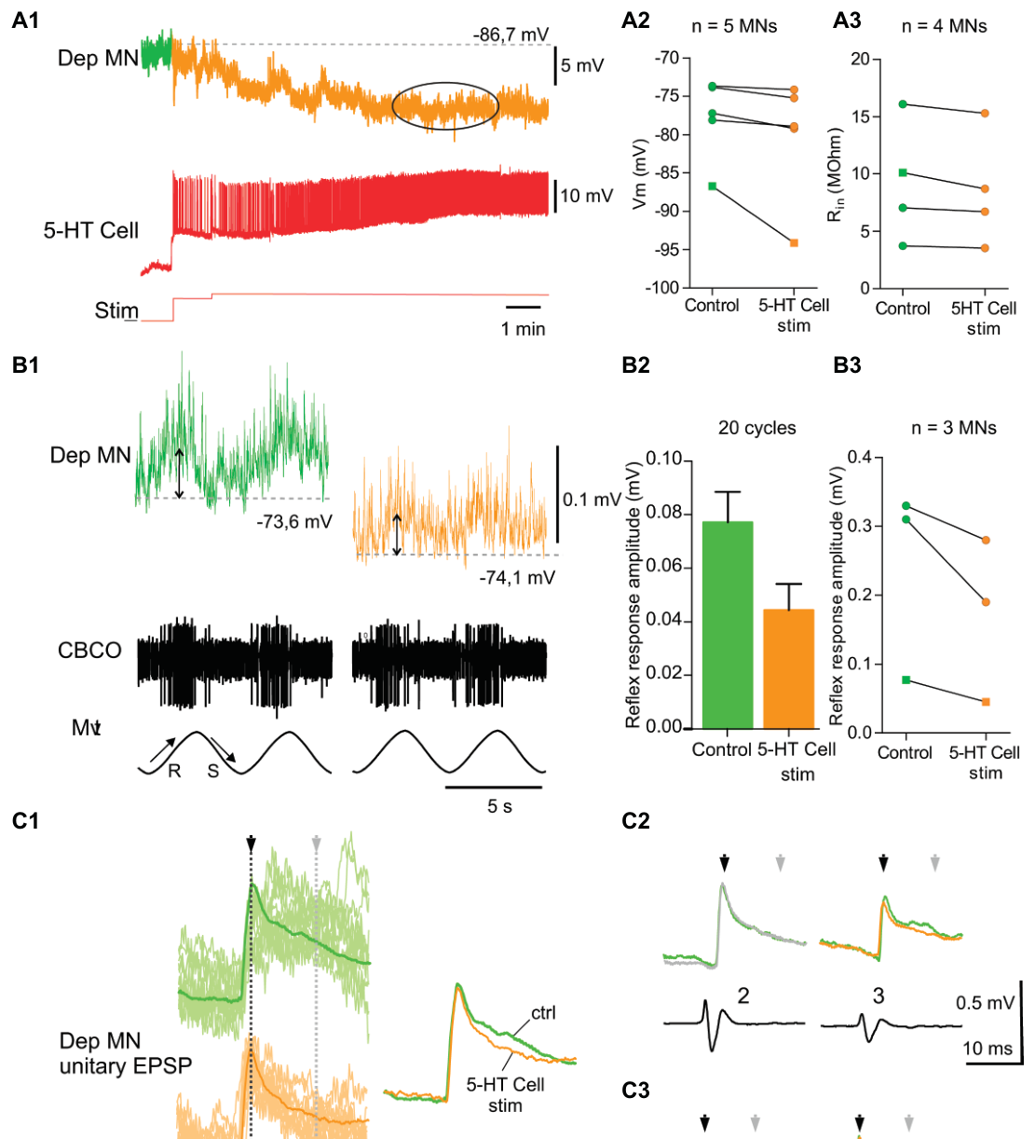
Motor modulation changes resistance and EPSPs
The effect of serotonin-cell activation can be examined at a single postsynaptic motor neuron. Bacqué-Cazenave and colleagues combined current injection with controlled movement of the coxo-basal chordotonal organ, a proprioceptor that senses movement at a walking-leg joint. The proprioceptor provides a controlled sensory input to the motor neuron.
Depressor neurons that were excited depolarized and gained input resistance, while inhibited neurons hyperpolarized and lost resistance. Sensory EPSPs grew or shrank in step with those shifts. Current pulses of known size supplied the measure of resistance, and the mV calibration was kept throughout.
Opposing membrane and synaptic changes can occur in neighboring motor neurons at the same time. The resistance change and the EPSP change follow the same direction in each neuron. Each neuron's resistance and EPSP are compared with its own baseline.
Bacqué-Cazenave et al. (2019), Fig. 4(A1–C3). Excited depressor neuron: resistance and sensory EPSP changes.
Bacqué-Cazenave et al. (2019), Fig. 5(A1–C3). Inhibited depressor neuron: resistance and sensory EPSP changes.
Bacqué-Cazenave et al. (2019)
42
Notes:
• The effect of serotonin-cell activation can be examined at a single postsynaptic motor neuron. Bacqué-Cazenave and colleagues combined current injection with controlled movement of the coxo-basal chordotonal organ, a proprioceptor that senses movement at a walking-leg joint.
• Excited depressor neurons depolarized and increased input resistance, while inhibited neurons hyperpolarized and decreased resistance. Sensory EPSPs became larger or smaller accordingly. The recordings retained mV calibration and included current pulses of known amplitude to estimate resistance.
– A proprioceptor reports the position or movement of the animal’s own body. Its stimulation supplies a controlled sensory input while the modulatory neuron is activated separately. A changed EPSP can reflect both membrane resistance and other synaptic changes, so the two measurements are interpreted together rather than assigned to one mechanism automatically.
• Opposing membrane and synaptic effects connect modulation to sensory-motor output at identified targets. They are consistent with different receptor actions or receptor distributions, but do not by themselves identify the molecular subtype on each cell. These motor-neuron measurements also cannot replace direct tests of the giant escape system or of fighting behavior.
References:
Julien Bacqué-Cazenave; Pascal Fossat; Fadi A. Issa; Donald H. Edwards; Jean Paul Delbecque; Daniel Cattaert (2019). Duality of 5-HT Effects on Crayfish Motoneurons. Frontiers in Physiology, 10: 1280. https://doi.org/10.3389/fphys.2019.01280
Figure: Bacqué-Cazenave et al. (2019), Fig. 4(A1–C3). Excited depressor neuron: resistance and sensory EPSP changes.
Figure source: https://doi.org/10.3389/fphys.2019.01280
Figure: Bacqué-Cazenave et al. (2019), Fig. 5(A1–C3). Inhibited depressor neuron: resistance and sensory EPSP changes.
Figure source: https://doi.org/10.3389/fphys.2019.01280

Slide 56
Serotonin cells split motor units in opposite directions
Bacqué-Cazenave and colleagues stimulated one identified serotonin neuron in the first abdominal ganglion of isolated adult crayfish. Current pulses inside the cell drove it, and the team recorded individual walking-leg motor units and motor-neuron voltage at the same time.
A 10 s activation produced excitation in some units, inhibition in others and little change in still others. In the same recording, one depressor neuron depolarized while another unit in its nerve reduced its discharge. Changes in the average nerve activity can conceal these opposing effects.
The effect of one serotonin neuron can therefore push different motor units in opposite directions. The population average hides this split, so each unit is followed on its own, and each motor-unit response is compared with its baseline.
Bacqué-Cazenave et al. (2019), Fig. 4(A1–C3). Excited depressor neuron: resistance and sensory EPSP changes.
Bacqué-Cazenave et al. (2019), Fig. 5(A1–C3). Inhibited depressor neuron: resistance and sensory EPSP changes.
Bacqué-Cazenave et al. (2019)
42a
Notes:
• One serotonin neuron pushes motor units in opposite directions.
• Activation.
– Current pulses drove an identified serotonin neuron.
– Motor units were recorded individually.
• Responses.
– Some units were excited, others inhibited.
– Some changed little.
• Averages.
– One depressor depolarized while another unit fell.
– The average nerve activity hides this split.
• Meaning.
– Each unit must be followed on its own.
– The baseline is set per unit.
• Source values.
– The published recordings and measurements come from the original paper.
– Each result is reported with the condition used in the source.
• Why the measure matters.
– The result separates the measured property from the mechanism that produces it.
– The comparison stays within the same animals, ganglia or cells.
• Interpretation.
– Each result is read within the preparation and social history that produced it.
– The claim is restricted to the measured animals and conditions.
• Context.
– The parent figure shows the measurement that the paragraphs describe.
– Each claim is tied to the recordings of the original study.
• Method.
– The measurements follow the methods described in the original paper.
– Each value is kept with the condition under which it was measured.
References:
Julien Bacqué-Cazenave; Pascal Fossat; Fadi A. Issa; Donald H. Edwards; Jean Paul Delbecque; Daniel Cattaert (2019). Duality of 5-HT Effects on Crayfish Motoneurons. Frontiers in Physiology, 10: 1280. https://doi.org/10.3389/fphys.2019.01280

Slide 57
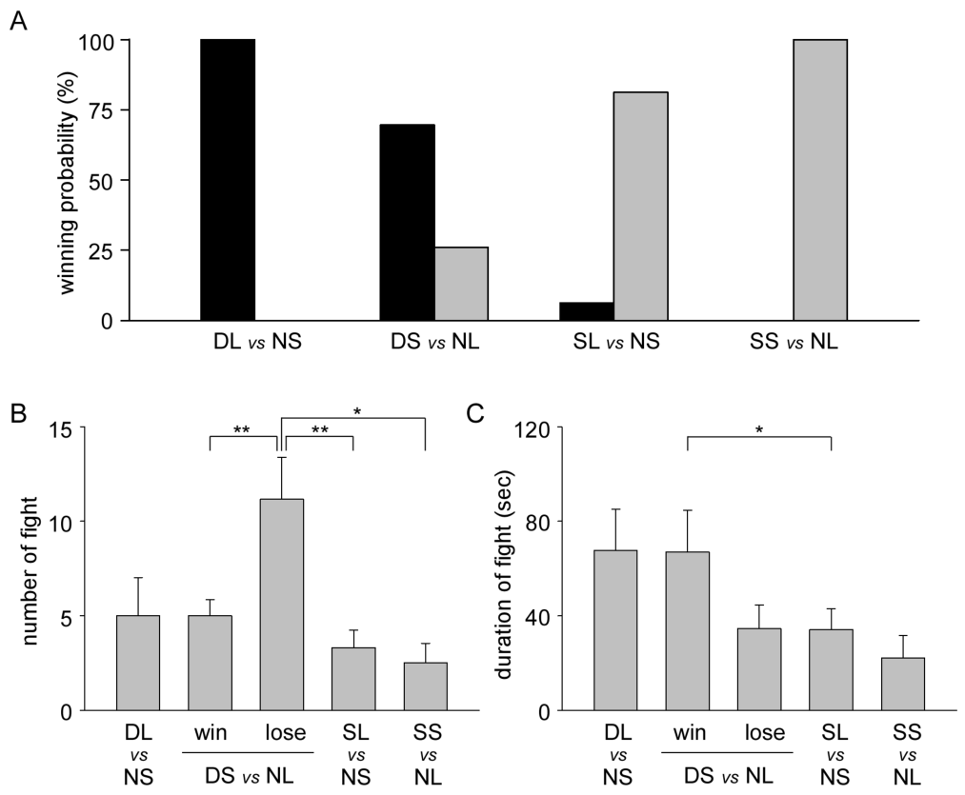

Previous success and amines alter later contest outcomes
A winner effect is increased success after a previous victory, whereas a loser effect is reduced success after defeat. Momohara and colleagues paired adult male crayfish with modest size differences. They then tested experienced animals against unfamiliar opponents on the following day, so each contest follows a known history.
Smaller animals that had won before defeated naive larger opponents about 70% of the time. Larger animals that had lost before won only about 6% against smaller naive ones. Injecting serotonin into naive smaller animals raised their win rate above 60% under the same conditions.
Experience and pharmacology both shape the outcome of a later contest. The prior history of each animal is linked to the result of its next encounter. Each win rate is compared with the matched naive control group. Each win rate is also compared with the rank of the animal that produced it.
Momohara et al. (2013), Fig. 3(A). Serotonin injection changes winning probability.
Momohara et al. (2013), Fig. 2(A–C). Previous winning and losing alter subsequent encounters.
Momohara et al. (2013)
43
Notes:
• A winner effect is increased success after a previous victory; a loser effect is reduced success after defeat. Momohara and colleagues paired adult male crayfish with modest size differences, then tested experienced animals against unfamiliar opponents on the following day.
• Previously successful smaller animals won about 70% of later pairings against larger naive opponents. Previously defeated larger animals won only about 6% against smaller naive animals. Serotonin injection into naive smaller animals also increased winning to over 60% under the tested conditions.
– Naive denotes an animal without the prior pairing used to assign winner or loser experience. Size differences were small enough for experience to influence the outcome, unlike the large asymmetry used in Huber and colleagues’ persistence experiments. The final winner and the length of an encounter are therefore separate experimental outcomes.
• Experience and pharmacological treatment can therefore outweigh a modest physical advantage. The injected serotonin solution was 1–2 µM, distinct from a measured tissue concentration. These outcomes do not identify the LG circuit as the cause of winning or establish that endogenous serotonin alone carries the full memory of victory.
References:
Yuto Momohara; Akihiro Kanai; Toshiki Nagayama (2013). Aminergic Control of Social Status in Crayfish Agonistic Encounters. PLoS ONE, 8(9): e74489. https://doi.org/10.1371/journal.pone.0074489
Figure: Momohara et al. (2013), Fig. 2(A–C). Previous winning and losing alter subsequent encounters.
Figure source: https://doi.org/10.1371/journal.pone.0074489
Figure: Momohara et al. (2013), Fig. 3(A). Serotonin injection changes winning probability.
Figure source: https://doi.org/10.1371/journal.pone.0074489

Slide 58


Drug effects depend on social history and treatment timing
Fluoxetine inhibits serotonin uptake, which reduces the removal of serotonin into cells. Huber and colleagues found that co-treatment with fluoxetine reduced the fighting-duration increase caused by infused serotonin in established subordinates. Acute fluoxetine alone produced a smaller persistence increase, so the two treatments are compared directly.
Momohara and colleagues treated animals only after they had gained dominance, then tested a fresh encounter the next day. Fluoxetine strengthened the winner effect, and the serotonin antagonist mianserin weakened it. The two protocols differed in species, previous rank and timing.
The outcome of a drug therefore depends on the social history and the timing of treatment. The same class of drug can strengthen or weaken the same social effect. Each drug result is read with the rank and schedule of its animals.
Huber et al. (1997), Fig. 3. Fight duration after serotonin and fluoxetine treatment.
Momohara et al. (2013), Fig. 4(A–E). Pharmacological effects on previously dominant animals.
Huber et al. (1997); Momohara et al. (2013)
44
Notes:
• Fluoxetine inhibits serotonin uptake, reducing its removal into cells. Huber and colleagues found that co-treatment with fluoxetine reduced the fighting-duration increase caused by infused serotonin in established subordinates. Acute fluoxetine alone did not produce the same persistence increase.
• Momohara and colleagues instead treated animals after they acquired dominance and tested a new encounter on the following day. Fluoxetine reinforced the winner effect, whereas the serotonin antagonist mianserin reduced it. These protocols differed in species, previous rank and timing.
– An antagonist reduces a receptor-mediated response, but drug specificity can differ among species and receptor subtypes. Mianserin-sensitive winning and fluoxetine-sensitive persistence remain behavioral pharmacological results. The studies must be compared using their actual treatment sequence rather than assuming that more extracellular serotonin always produces the same outcome.
• The outcomes are not interchangeable measures of a universal aggression mechanism. One tested an acute serotonin-dependent change during an ongoing size-asymmetric relationship; the other tested subsequent contest success after experience. Uptake-related pharmacology supports serotonin involvement, but neither experiment identifies every affected receptor or the relevant circuit.
References:
Robert Huber; Kalim Smith; Antonia Delago; Karin Isaksson; Edward A. Kravitz (1997). Serotonin and aggressive motivation in crustaceans: Altering the decision to retreat. Proceedings of the National Academy of Sciences, 94(11): 5939-5942. https://doi.org/10.1073/pnas.94.11.5939
Yuto Momohara; Akihiro Kanai; Toshiki Nagayama (2013). Aminergic Control of Social Status in Crayfish Agonistic Encounters. PLoS ONE, 8(9): e74489. https://doi.org/10.1371/journal.pone.0074489
Figure: Huber et al. (1997), Fig. 3. Fight duration after serotonin and fluoxetine treatment.
Figure source: https://doi.org/10.1073/pnas.94.11.5939
Figure: Momohara et al. (2013), Fig. 4(A–E). Pharmacological effects on previously dominant animals.
Figure source: https://doi.org/10.1371/journal.pone.0074489

Slide 59


Defeat can increase avoidance after the encounter
Bacqué-Cazenave and colleagues tested anxiety-like behavior, operationally defined as increased avoidance of illuminated maze arms and more retreats at dark-light boundaries. Male crayfish were paired for 20 min and then tested individually, so the behavior is measured after the fight rather than during it.
Losers avoided light more than winners and isolated controls. Continued attacks after defeat predicted avoidance more closely than fight duration did. Pretreatment with methysergide, a serotonin antagonist, increased time in the light arms from roughly 20% to 40% in subsequent losers, while reducing boundary retreats.
Defeat therefore shapes avoidance after the encounter has ended. The number of attacks a loser endures predicts how strongly it avoids light. Each animal's maze behavior is compared with the matched winner and control groups.
Bacqué-Cazenave et al. (2017), Fig. 2(A–D). Maze behavior after winning or losing, with anxiolytic treatment.
Bacqué-Cazenave et al. (2017), Fig. 4(A–C). Serotonin measurements and antagonist effects on avoidance.
Bacqué-Cazenave et al. (2017)
45
Notes:
• Bacqué-Cazenave and colleagues tested anxiety-like behavior, operationally defined as increased avoidance of illuminated maze arms and more retreats at dark-light boundaries. Male crayfish were paired for 20 min, then tested individually rather than measuring escape during the fight.
• Losers avoided light more than winners and isolated controls. Continued attacks after defeat predicted avoidance more closely than fight duration. Pretreatment with methysergide, a serotonin antagonist, increased time in light arms from roughly 20% to 40% in subsequent losers while reducing boundary retreats.
– Anxiolytic treatment with chlordiazepoxide also reduced the loser’s avoidance, supporting the authors’ anxiety-like behavioral classification. Serotonin was measured in tissue extracts as an additional association, but pharmacology and avoidance do not localize the relevant circuit. Continued attacks after defeat are a different exposure from the contest that established rank.
• The drug-treated animals could still lose and withdraw, separating later avoidance from the initial decision to retreat. The assay supports a serotonin-associated effect of social stress, but does not identify a giant escape-neuron mechanism or establish a human subjective emotional state from behavior alone.
References:
Julien Bacqué-Cazenave; Daniel Cattaert; Jean-Paul Delbecque; Pascal Fossat (2017). Social harassment induces anxiety-like behaviour in crayfish. Scientific Reports, 7(1): 39935. https://doi.org/10.1038/srep39935
Figure: Bacqué-Cazenave et al. (2017), Fig. 2(A–D). Maze behavior after winning or losing, with anxiolytic treatment.
Figure source: https://doi.org/10.1038/srep39935
Figure: Bacqué-Cazenave et al. (2017), Fig. 4(A–C). Serotonin measurements and antagonist effects on avoidance.
Figure source: https://doi.org/10.1038/srep39935

Slide 60
Key takeaways
Circuit selection: Dominance changes the balance of attacks, retreats and escape types. Frequent subordinate escape does not imply frequent lateral giant activation.
Context and history: LG excitability during interaction differs from excitability at rest. Serotonin’s effect depends on past rank, current experience and drug-delivery conditions.
Plasticity over days: Subordinate serotonin inhibition develops after the initial behavioral decision and can reverse after isolation. Previous dominance can persist in LG modulation after demotion.
Synaptic and cellular gain: Rectifying electrical inputs and membrane conductance contribute to LG responsiveness. cAMP interventions support a postsynaptic facilitatory pathway in the tested preparation.
Receptor evidence: Agonist effects, cloned-receptor signaling and immunostaining answer different questions. The mapped type-1 receptor was not detected on LG; its direct role there is unproven.
Behavioral specificity: Fighting persistence, contest success, walking-leg orientation and post-defeat avoidance are distinct outcomes. Serotonin does not impose a single sign across all cells or behaviors.
Herberholz et al. (2001); Yeh et al. (1997); Araki et al. (2005); Spitzer et al. (2005, 2008)
46
Notes:
References:
Jens Herberholz; Fadi A. Issa; Donald H. Edwards (2001). Patterns of Neural Circuit Activation and Behavior during Dominance Hierarchy Formation in Freely Behaving Crayfish. The Journal of Neuroscience, 21(8): 2759-2767. https://doi.org/10.1523/jneurosci.21-08-02759.2001
Franklin B. Krasne; Ashkan Shamsian; Raghavendra Kulkarni (1997). Altered Excitability of the Crayfish Lateral Giant Escape Reflex during Agonistic Encounters. The Journal of Neuroscience, 17(2): 709-716. https://doi.org/10.1523/jneurosci.17-02-00709.1997
Shih-Rung Yeh; Barbara E. Musolf; Donald H. Edwards (1997). Neuronal Adaptations to Changes in the Social Dominance Status of Crayfish. The Journal of Neuroscience, 17(2): 697-708. https://doi.org/10.1523/jneurosci.17-02-00697.1997
Makoto Araki; Toshiki Nagayama; Jordanna Sprayberry (2005). Cyclic AMP Mediates Serotonin-Induced Synaptic Enhancement of Lateral Giant Interneuron of the Crayfish. Journal of Neurophysiology, 94(4): 2644-2652. https://doi.org/10.1152/jn.00502.2005
Nadja Spitzer; Brian L. Antonsen; Donald H. Edwards (2005). Immunocytochemical mapping and quantification of expression of a putative type 1 serotonin receptor in the crayfish nervous system. The Journal of Comparative Neurology, 484(3): 261-282. https://doi.org/10.1002/cne.20456
Nadja Spitzer; Donald H. Edwards; Deborah J. Baro (2008). Conservation of structure, signaling and pharmacology between two serotonin receptor subtypes from decapod crustaceans, Panulirus interruptus and Procambarus clarkii. Journal of Experimental Biology, 211(1): 92-105. https://doi.org/10.1242/jeb.012450
Julien Bacqué-Cazenave; Pascal Fossat; Fadi A. Issa; Donald H. Edwards; Jean Paul Delbecque; Daniel Cattaert (2019). Duality of 5-HT Effects on Crayfish Motoneurons. Frontiers in Physiology, 10: 1280. https://doi.org/10.3389/fphys.2019.01280
Julien Bacqué-Cazenave; Daniel Cattaert; Jean-Paul Delbecque; Pascal Fossat (2017). Social harassment induces anxiety-like behaviour in crayfish. Scientific Reports, 7(1): 39935. https://doi.org/10.1038/srep39935

