Slide 1

Wednesday, December 2, 2026
NEUR 411 · NEUROETHOLOGY · FALL 2026
Lecture 39
Hormones and behavior: the ring dove reproductive cycle (Lehrman) and seasonal song plasticity
Wednesday, December 2, 2026
Jordan Lopez, Ph.D.
Professor of Neurobiology & Biomedical Engineering
Photo: Domestic ring dove.
Frits Schouten / iNaturalist · CC BY-NC 4.0
Notes:
Hormones and behavior: the ring dove reproductive cycle (Lehrman) and seasonal song plasticity
Wednesday, December 2, 2026
Photo credit: Frits Schouten / iNaturalist; CC BY-NC 4.0; https://www.inaturalist.org/photos/7178728

Slide 2
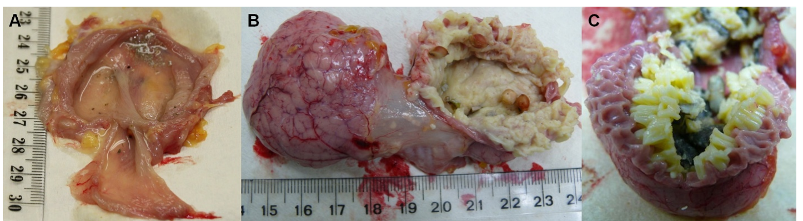
Parental feeding depends on physiology and experience
Ring doves are domesticated columbids in which both parents incubate eggs and feed their young. Lehrman described a clutch of two eggs, about 14 days of incubation, and parental regurgitation of crop contents into the squab, the newly hatched young bird. Lehrman's ring-dove experiments tested whether this parental feeding depended on the hormones and experience that prepare the adult for it.
The crop is a bilobed expansion of the esophagus. Its epithelial lining proliferates during incubation and supplies the cellular material called crop milk. Pigeon dissections distinguish a thin non-lactating wall from enlarged, milk-producing lateral lobes. Pigeon crop epithelium therefore serves as a measurable, peripheral marker of the milk-producing state.
Milk-producing tissue supplies nourishment for the young, and its growth is part of the parental program that begins during incubation. The crop therefore links a hormone-driven tissue change to the feeding behavior that follows. Feeding behavior and crop physiology are both measured, so the link between tissue and behavior can be examined directly.
Gillespie et al. (2011), Fig. 1(A–C). Non-lactating and milk-producing pigeon crops; ruler in cm.
Lehrman (1955); Gillespie et al. (2011)
2
Notes:
Ring doves are domesticated columbids in which both parents incubate eggs and feed their young. Lehrman described a clutch of two eggs, approximately 14 days of incubation, and parental regurgitation of crop contents into the squab, the newly hatched young bird.
The crop is a bilobed expansion of the esophagus. Its epithelial lining proliferates during incubation and supplies the cellular material called crop milk. Modern pigeon dissections distinguish a thin non-lactating wall from enlarged, milk-producing lateral lobes.
The anatomical comparison concerns pigeons, whereas Lehrman’s behavioral experiments concern ring doves. Milk-producing tissue supplies nourishment, but its presence alone does not establish that a parent will recognize or feed a squab.
References:
Lehrman DS (1955). The physiological basis of parental feeding behavior in the ring dove (Streptopelia risoria). Behaviour 7:241–286. https://doi.org/10.1163/156853955X00094
Gillespie MJ, Haring VR, McColl KA, Monaghan P, Donald JA, Nicholas KR, Moore RJ, Crowley TM (2011). Histological and global gene expression analysis of the ‘lactating’ pigeon crop. BMC Genomics 12:452. https://doi.org/10.1186/1471-2164-12-452
Figure sources:
Gillespie et al. (2011), Fig. 1(A–C). Non-lactating and milk-producing pigeon crops; ruler in cm. https://doi.org/10.1186/1471-2164-12-452

Slide 3
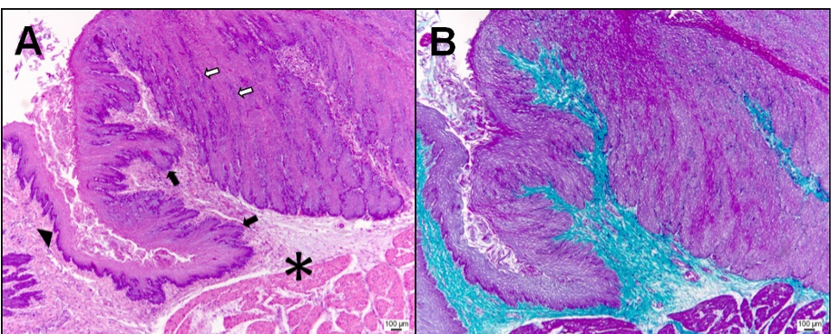
Prolactin-induced feeding requires prior brood experience
Prolactin is a pituitary hormone that promotes crop development in columbids. Lehrman administered 450 international units over 7 days and then presented a squab, comparing hormonally treated birds with controls and separating birds by their reproductive history. The hormone was given in a fixed sequence, so the timing of the squab presentation followed the same schedule in every bird.
Previously experienced parents generally began feeding after prolactin treatment. Birds without prior brood experience failed to feed under the same artificial sequence, even though they responded physiologically to the treatment. Prior experience changed the behavioral consequence of the hormone. The contrast between experienced and inexperienced birds shows that the same hormone dose produced different behavior.
Pigeon histology identifies proliferating crop epithelium, the peripheral tissue that supplies milk. This tissue response is measured in the periphery, so the crop provides a visible sign of the hormonal change that accompanies feeding. Histology shows the proliferating epithelium that accompanies the milk-producing state in the same tissue.
Gillespie et al. (2011), Fig. 2(A,B). Pigeon crop epithelial proliferation and connective tissue.
Lehrman (1955); Gillespie et al. (2011)
3
Notes:
Prolactin is a pituitary hormone that promotes crop development in columbids. Lehrman administered a total of 450 international units over 7 days and then presented a squab, comparing hormonally treated birds with controls and distinguishing birds with different reproductive histories.
Previously experienced parents generally began feeding after prolactin treatment. Birds without prior brood experience failed to feed under the same artificial sequence, despite physiological responses to treatment. Prior experience therefore changed the behavioral consequence of a hormone.
Pigeon histology identifies proliferating crop epithelium, the peripheral tissue affected during milk production. The behavioral comparison does not identify a central prolactin receptor or establish that prolactin acts only outside the nervous system.
References:
Lehrman DS (1955). The physiological basis of parental feeding behavior in the ring dove (Streptopelia risoria). Behaviour 7:241–286. https://doi.org/10.1163/156853955X00094
Gillespie MJ, Haring VR, McColl KA, Monaghan P, Donald JA, Nicholas KR, Moore RJ, Crowley TM (2011). Histological and global gene expression analysis of the ‘lactating’ pigeon crop. BMC Genomics 12:452. https://doi.org/10.1186/1471-2164-12-452
Figure sources:
Gillespie et al. (2011), Fig. 2(A,B). Pigeon crop epithelial proliferation and connective tissue. https://doi.org/10.1186/1471-2164-12-452

Slide 4
Prolactin feeding depends on brood experience
Lehrman's prolactin protocol delivered 450 international units over 7 days, after which a squab was presented to each bird. The design compared treated birds with controls and grouped the birds by whether they had reared young before. Each parent's feeding was recorded against its own history. The hormone sequence and the feeding test were carried out in the same birds.
Experienced parents usually began feeding once prolactin had been given. Inexperienced birds failed to feed under the same sequence, although they responded physiologically to the hormone. The behavioral outcome therefore depended on the bird's history as well as the hormone. The experienced parents and the inexperienced birds were both tested with the same squab.
The crop's proliferating epithelium is the tissue that supplies milk, and it responds in the periphery. A physiological change in the crop therefore accompanies the hormone treatment, while the feeding decision depends on the bird's experience. The crop tissue therefore identifies the physiology that the behavioral test follows.
Gillespie et al. (2011), Fig. 2(A,B). Pigeon crop epithelial proliferation and connective tissue.
Lehrman (1955)
3a
Notes:
Prolactin feeding depends on brood experience.
Explanation 1.
Lehrman's prolactin protocol delivered 450 international units over 7 days, after which a squab was presented to each bird
The design compared treated birds with controls and grouped the birds by whether they had reared young before. Each parent's feeding was recorded against its own history. The hormone sequence and the feeding test were carried out in the same birds.
Explanation 2.
Experienced parents usually began feeding once prolactin had been given
Inexperienced birds failed to feed under the same sequence, although they responded physiologically to the hormone. The behavioral outcome therefore depended on the bird's history as well as the hormone. The experienced parents and the inexperienced birds were both tested with the same squab.
Explanation 3.
The crop's proliferating epithelium is the tissue that supplies milk, and it responds in the periphery
A physiological change in the crop therefore accompanies the hormone treatment, while the feeding decision depends on the bird's experience. The crop tissue therefore identifies the physiology that the behavioral test follows.
Source.
The figure and the measurements come from Lehrman (1955).
Each statement is tied to the recordings or observations of that study.
References:
Lehrman DS (1955). The physiological basis of parental feeding behavior in the ring dove (Streptopelia risoria). Behaviour 7:241–286. https://doi.org/10.1163/156853955X00094

Slide 5
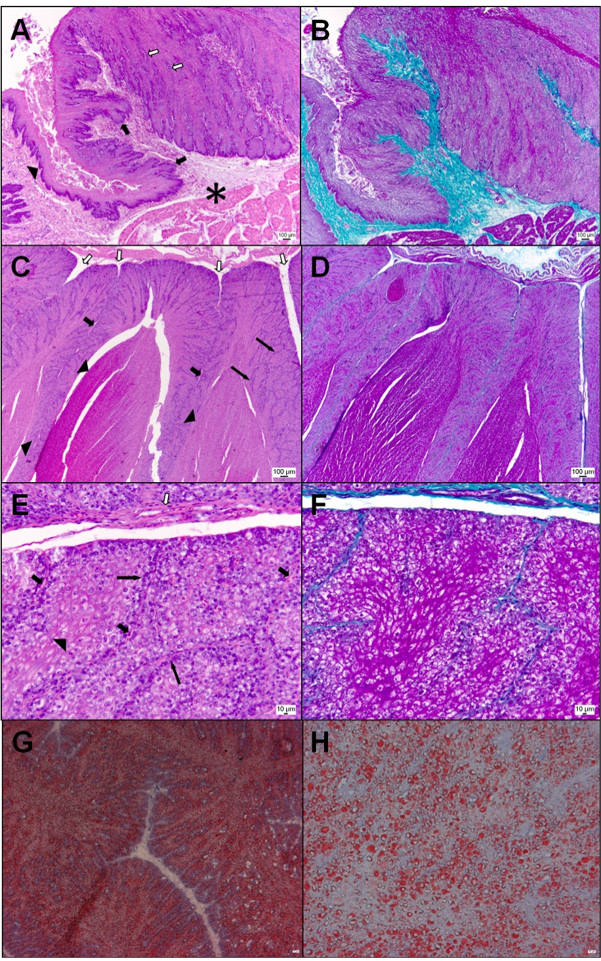
Crop sensation contributes to parental feeding
Lehrman reduced sensation near the crop by applying 0.5 cubic centimeters of the local anesthetic Efocaine 2 days before a squab was presented. A comparison group received the anesthetic elsewhere on the body, which controlled for the effects of the drug itself. The anesthetic was delivered at a fixed interval before the squab presentation, so the timing of the block was controlled.
Local treatment near the crop reduced parental feeding. Peripheral feedback is sensory information returning from the body to the nervous system, and crop distension and contact with a squab are candidate sources of that information. Crop distension and direct contact both give the bird sensory information from the crop during feeding.
The location of the anesthetic determined the behavioral outcome, which points to a sensory contribution from the crop. The crop tissue shown here comes from pigeons, while the feeding experiments used ring doves. The anesthetic effect was therefore tied to the location of the block, which points to the crop as the source of the signal.
Gillespie et al. (2011), Fig. 2(A–H). Pigeon crop epithelium, vasculature and lipid staining.
Lehrman (1955); Gillespie et al. (2011)
4
Notes:
Lehrman reduced sensation near the crop using 0.5 cubic centimeters of the local anesthetic Efocaine, administered 2 days before a squab was presented. A comparison group received anesthetic elsewhere, controlling for consequences of receiving the drug rather than its location.
Local treatment near the crop reduced parental feeding. Peripheral feedback means sensory information returning from the body to the nervous system; crop distension and contact with a squab were candidate sources of such information.
The crop tissue displayed here is from pigeons, not the anesthetized ring doves. The location-dependent behavioral effect supports a sensory contribution, but drug spread and other local effects prevent identifying one sensory receptor or excluding central hormone actions.
References:
Lehrman DS (1955). The physiological basis of parental feeding behavior in the ring dove (Streptopelia risoria). Behaviour 7:241–286. https://doi.org/10.1163/156853955X00094
Gillespie MJ, Haring VR, McColl KA, Monaghan P, Donald JA, Nicholas KR, Moore RJ, Crowley TM (2011). Histological and global gene expression analysis of the ‘lactating’ pigeon crop. BMC Genomics 12:452. https://doi.org/10.1186/1471-2164-12-452
Figure sources:
Gillespie et al. (2011), Fig. 2(A–H). Pigeon crop epithelium, vasculature and lipid staining. https://doi.org/10.1186/1471-2164-12-452

Slide 6
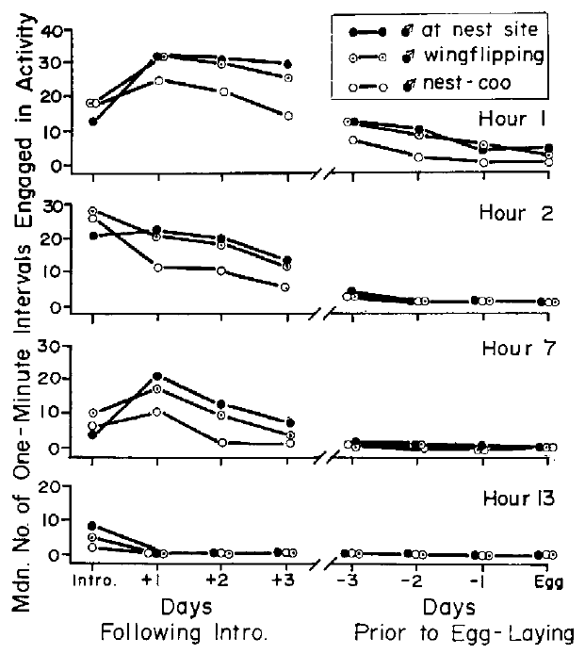
Partners perform complementary nest-building actions
Ring-dove nest building involves a division of labor: males usually gather and transport material, while females remain at the nest site and tuck material into the developing nest. Martinez-Vargas and Erickson recorded these actions separately during the days before the first egg. Males gathered and carried material, and females placed it, so each partner's share of the work was recorded separately.
Established pairs received space, nest sites and alternative materials. Repeated observations related the male's gathering to the female's attendance and construction, rather than treating total nest size as the only behavioral measure. Each pair received the same nest materials, so differences in gathering reflect the birds rather than the supply.
Male transport increased when females were established at the nest, so each partner's activity responded to the other. Coordinated behavior can arise through signals exchanged between the birds during the nesting period. The transport response to female attendance shows that male behavior tracks the activity of the female at the nest.
Martinez-Vargas & Erickson (1973), Fig. 3. Male nest attendance, wing-flipping and nest-cooing.
Martinez-Vargas & Erickson (1973)
5
Notes:
Ring-dove nest building involves a division of labor: males usually gather and transport material, while females remain at the nest site and tuck material into the developing nest. Martinez-Vargas and Erickson recorded these actions separately during the days before the first egg.
Established pairs received space, nest sites and alternative materials. Repeated observations related the male’s gathering to the female’s attendance and construction rather than treating total nest size as the only behavioral measurement.
Transport increased when females were established at the nest. Coordinated behavior can therefore arise through signals exchanged between partners; simultaneous increases in both birds’ activity do not by themselves establish simultaneous increases in a shared circulating hormone.
References:
Martinez-Vargas MC, Erickson CJ (1973). Some social and hormonal determinants of nest-building behaviour in the ring dove (Streptopelia risoria). Behaviour 45:12–36. https://doi.org/10.1163/156853974X00570
Figure sources:
Martinez-Vargas & Erickson (1973), Fig. 3. Male nest attendance, wing-flipping and nest-cooing. https://doi.org/10.1163/156853974X00570

Slide 7
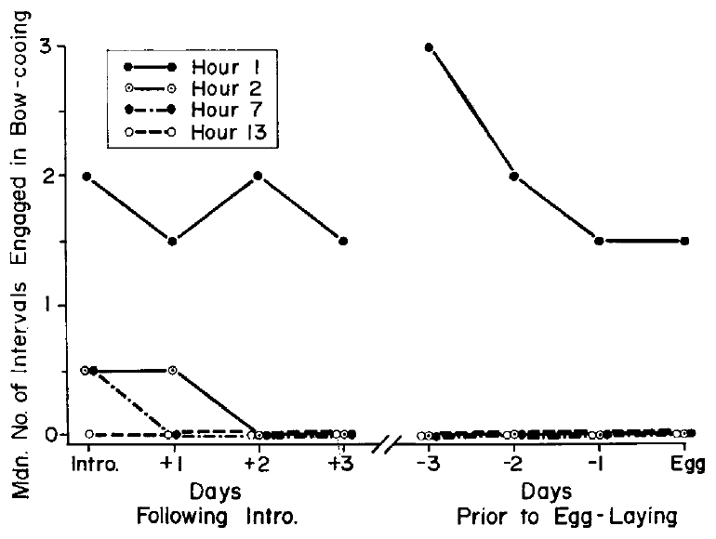
Courtship components change at different rates
Bow-cooing is a male courtship vocalization accompanied by a bowing display. Martinez-Vargas and Erickson recorded its frequency across days aligned to the first egg, which allowed a comparison with nest-material transport and female nest attendance in the same reproductive period. Bow-cooing and bowing were recorded together, so the vocal and postural elements of the display were measured as one unit.
Bow-cooing declined as nesting progressed, while material gathering followed a different time course. The behavioral components changed together within the breeding cycle, but they did not share one trajectory or one function. Each component followed its own time course relative to the first egg, which the daily records resolved.
Aligning the records to egg laying provides a common reference event for the observable actions. The temporal pattern shows how the components are arranged across the cycle, which is the basis for testing their links with hormones. The shared reference to egg laying allows the pattern of each behavior to be traced across the same reproductive cycle.
Martinez-Vargas & Erickson (1973), Fig. 7. Bow-cooing frequency relative to the first egg.
Martinez-Vargas & Erickson (1973)
6
Notes:
Bow-cooing is a male courtship vocalization accompanied by a bowing display. Martinez-Vargas and Erickson recorded its frequency across days aligned to the first egg, permitting comparison with nest-material transport and female nest attendance in the same reproductive period.
Bow-cooing declined as nesting progressed, while material gathering followed a different time course. Behavioral components therefore changed together within a breeding cycle without having identical trajectories or an interchangeable function.
Alignment to egg laying supplies a common reference event, not a manipulation of the underlying endocrine system. The records establish temporal relationships among observable actions but cannot determine whether a decline in vocalization directly causes the increase in construction.
References:
Martinez-Vargas MC, Erickson CJ (1973). Some social and hormonal determinants of nest-building behaviour in the ring dove (Streptopelia risoria). Behaviour 45:12–36. https://doi.org/10.1163/156853974X00570
Figure sources:
Martinez-Vargas & Erickson (1973), Fig. 7. Bow-cooing frequency relative to the first egg. https://doi.org/10.1163/156853974X00570

Slide 8
Female nest-cooing marks the nesting phase
Female nest-cooing is a vocal display given at the nest site. Females join males in this display and may continue alone after the male leaves to gather material. Daily observations separated these vocalizations from bow-cooing and from physical construction. The pairs were recorded through the egg period, so the vocal record covers the whole reproductive stage.
Cheng described an abrupt end to female cooing after the second egg. That change marks the transition from nest building toward incubation, so the vocal record tracks the reproductive stage of the pair. The end of female cooing marks a clear behavioral boundary in the pair's reproductive timeline.
Records of when cooing happens establish the timing of the signal. Playback and hormone manipulations then test the physiological and social effects of cooing within the same pairs. The records therefore link the vocal phase to the stage of the pair's nest.
Martinez-Vargas & Erickson (1973), Fig. 7. Bow-cooing frequency relative to the first egg.
Martinez-Vargas & Erickson (1973)
6a
Notes:
Female nest-cooing marks the nesting phase.
Explanation 1.
Female nest-cooing is a vocal display given at the nest site
Females join males in this display and may continue alone after the male leaves to gather material. Daily observations separated these vocalizations from bow-cooing and from physical construction. The pairs were recorded through the egg period, so the vocal record covers the whole reproductive stage.
Explanation 2.
Cheng described an abrupt end to female cooing after the second egg
That change marks the transition from nest building toward incubation, so the vocal record tracks the reproductive stage of the pair. The end of female cooing marks a clear behavioral boundary in the pair's reproductive timeline.
Explanation 3.
Records of when cooing happens establish the timing of the signal
Playback and hormone manipulations then test the physiological and social effects of cooing within the same pairs. The records therefore link the vocal phase to the stage of the pair's nest.
Source.
The figure and the measurements come from Martinez-Vargas & Erickson (1973).
Each statement is tied to the recordings or observations of that study.
References:
Martinez-Vargas MC, Erickson CJ (1973). Some social and hormonal determinants of nest-building behaviour in the ring dove (Streptopelia risoria). Behaviour 45:12–36. https://doi.org/10.1163/156853974X00570

Slide 9
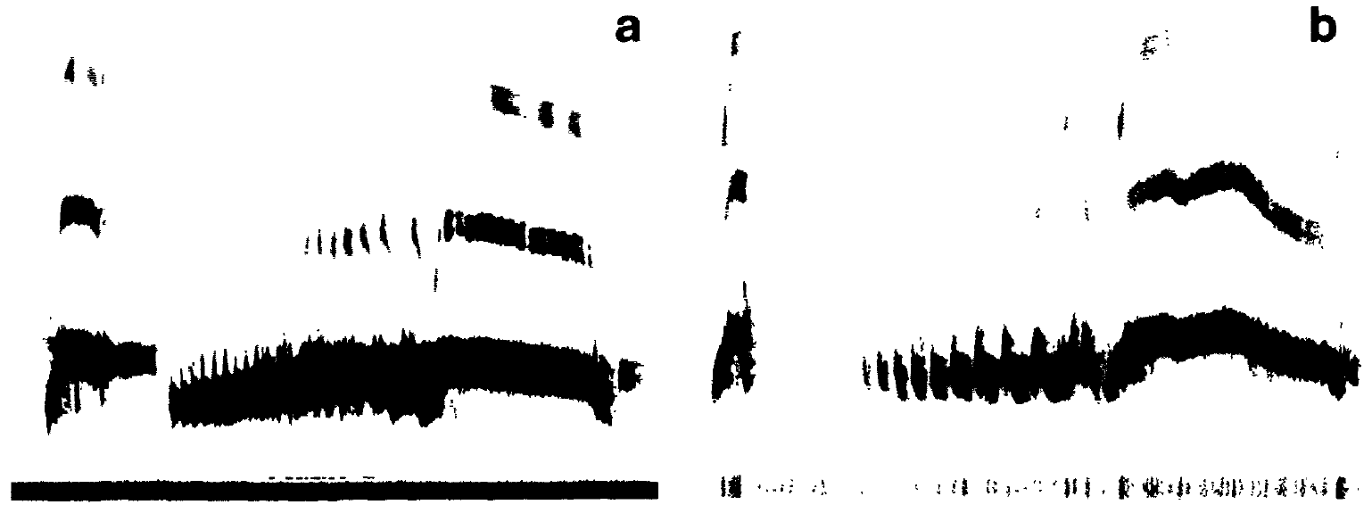
Female nest-cooing is a changing social signal
Nest-cooing is a vocal display given at the nest site. Females join males in this behavior and may continue alone after the male leaves to gather material. Daily observation distinguished female cooing from male bow-cooing and from physical nest construction. Nest-cooing is a display that both sexes produce, so the same vocal behavior can be compared across partners.
Martinez-Vargas and Erickson distinguished nest attendance from active nest soliciting. Cheng described an abrupt cessation of female cooing after the second egg, which linked the vocal phase to the transition toward incubation. Cheng's observation links the end of female cooing to the second egg, which marks the start of incubation.
A vocalization can influence a partner and also return sensory feedback to the bird that produces it. The records establish when cooing occurs, and playback or hormone manipulations are the means of testing its physiological and social effects. Vocal feedback to the female is therefore one candidate route by which the call shapes her reproductive state.
Cheng (1986), Fig. 1(a,b). Female and male ring-dove nest-coo sonograms.
Martinez-Vargas & Erickson (1973); Cheng (1986)
7
Notes:
Nest-cooing is a vocal display given at the nest site. Females join males in this behavior and may continue alone after the male leaves to gather material. Daily observation distinguished female cooing from male bow-cooing and from physical nest construction.
Martinez-Vargas and Erickson distinguished nest attendance from active nest soliciting. Cheng described an abrupt cessation of female cooing after the second egg, linking the vocal phase to the transition toward incubation rather than to a constant readiness to reproduce.
A vocalization can influence a partner and provide sensory feedback to its producer. These observational records establish when cooing occurs; separate playback and hormone manipulations are needed to test its physiological and social consequences.
References:
Martinez-Vargas MC, Erickson CJ (1973). Some social and hormonal determinants of nest-building behaviour in the ring dove (Streptopelia risoria). Behaviour 45:12–36. https://doi.org/10.1163/156853974X00570
Cheng MF (1986). Female cooing promotes ovarian development in ring doves. Physiology & Behavior 37:371–374. https://doi.org/10.1016/0031-9384(86)90248-9
Figure sources:
Cheng (1986), Fig. 1(a,b). Female and male ring-dove nest-coo sonograms. https://doi.org/10.1016/0031-9384(86)90248-9

Slide 10
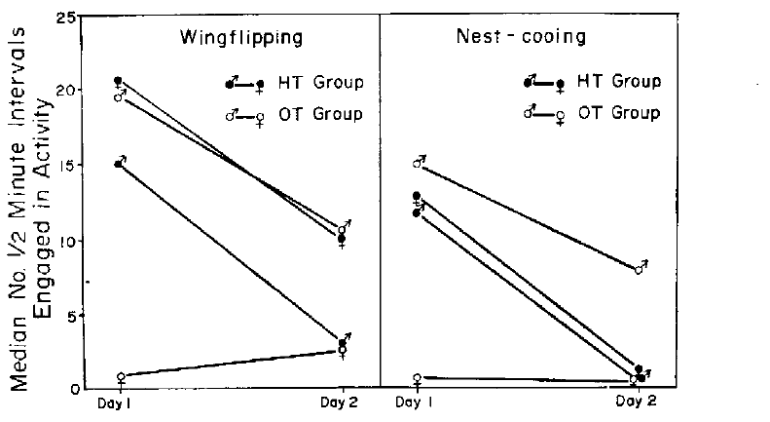
Female hormone treatment changes male gathering
Martinez-Vargas and Erickson compared females treated with estrogen and progesterone against oil-treated females before pairing them with males. Hormone replacement supplies an experimental endocrine signal, and the oil group controls for the injection and the vehicle that carries the hormones. The estrogen and progesterone treatment was given to the female before she was paired with a male, so the male met a treated partner.
On the first pairing day, treated females performed more nest soliciting, including wing-flipping and nest-cooing. Their untreated male partners also changed how they gathered material, and female nest attendance was closely associated with male transport. Treated females produced more of these displays on the first day, and the untreated males responded with more transport.
The female alone received the experimental hormones, so a change in male behavior reflects altered signals from his partner. Direct action of the hormones on the male is therefore a different route from the one this experiment tested. Partner signals are therefore a route by which a hormone given to one bird can alter the other bird's nest building.
Martinez-Vargas & Erickson (1973), Fig. 13. Nest soliciting after female hormone or oil treatment.
Martinez-Vargas & Erickson (1973)
8
Notes:
Martinez-Vargas and Erickson compared females treated with estrogen and progesterone with oil-treated females before pairing them with males. Hormone replacement supplies an experimental endocrine signal, while the oil comparison controls for injection and the vehicle carrying the hormones.
On the first pairing day, treated females performed more nest soliciting, including wing-flipping and nest-cooing. Their untreated male partners also participated differently in gathering material, and female nest attendance was closely associated with male transport.
Only the female received the experimental hormones. A change in male behavior therefore need not reflect direct drug action on the male; altered signals from his partner are a plausible route, although this experiment did not isolate every exchanged signal.
References:
Martinez-Vargas MC, Erickson CJ (1973). Some social and hormonal determinants of nest-building behaviour in the ring dove (Streptopelia risoria). Behaviour 45:12–36. https://doi.org/10.1163/156853974X00570
Figure sources:
Martinez-Vargas & Erickson (1973), Fig. 13. Nest soliciting after female hormone or oil treatment. https://doi.org/10.1163/156853974X00570

Slide 11
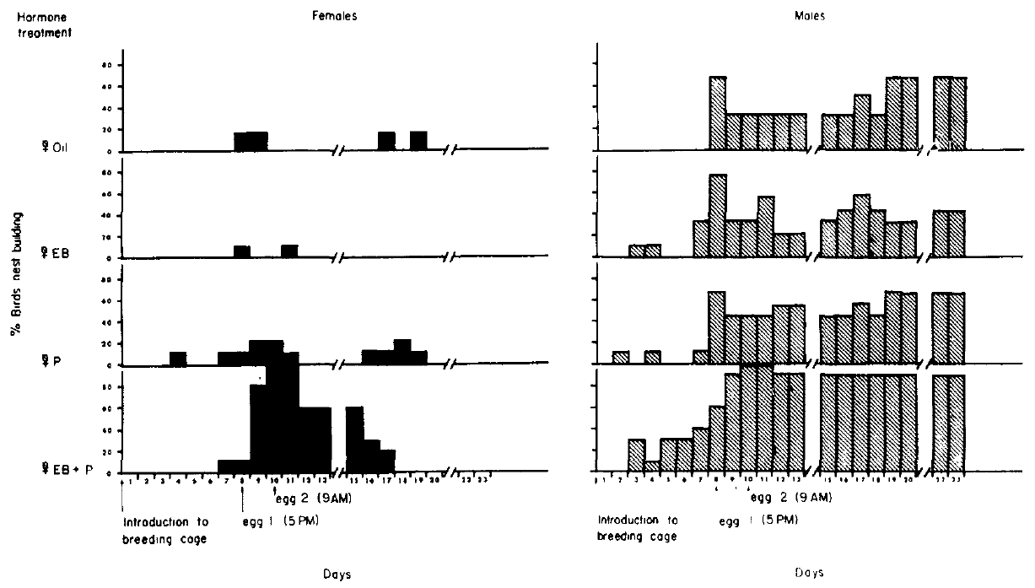
Sequential steroid treatment restores nest building
Cheng and Silver used reproductively experienced females after ovariectomy, the surgical removal of the ovaries, to reduce endogenous ovarian hormone contributions. They compared estradiol benzoate, progesterone, both steroids in a timed regimen, and sesame oil, with untreated males as partners. Ovariectomy removes the main source of ovarian steroids, so the replacement doses define the hormone state of each female.
Estradiol benzoate was given on courtship days 4–10. Progesterone was added on days 8 and 10 in the combined condition, after estrogen exposure had begun. The doses were 50 micrograms of estradiol benzoate and 100 micrograms of progesterone. The combined condition received both steroids on a fixed schedule, which defines the endocrine sequence under test.
The combined regimen produced the strongest nest-building response. Its timing supports a role for the sequence of endocrine signals, which the experiment established as a defined schedule that restored nest building. Nest building in the combined condition therefore depends on the sequence of estrogen followed by progesterone.
Cheng & Silver (1975), Fig. 1. Daily nest building by treated females and untreated males.
Cheng & Silver (1975)
9
Notes:
Cheng and Silver used reproductively experienced females after ovariectomy, surgical removal of the ovaries, to reduce endogenous ovarian hormone contributions. They compared estradiol benzoate, progesterone, both steroids in a timed regimen, and sesame oil, with untreated males as partners.
Estradiol benzoate was administered on courtship days 4–10. Progesterone was added on days 8 and 10 in the combined condition, after estrogen exposure had begun. The administered doses were 50 micrograms of estradiol benzoate and 100 micrograms of progesterone.
The combined regimen produced the strongest nest-building response. Its timing supports a role for endocrine sequence, but the study did not compare every possible order and therefore cannot establish that this particular schedule is uniquely required.
References:
Cheng MF, Silver R (1975). Estrogen-progesterone regulation of nest-building and incubation behavior in ovariectomized ring doves (Streptopelia risoria). Journal of Comparative and Physiological Psychology 88:256–263. https://doi.org/10.1037/h0076181
Figure sources:
Cheng & Silver (1975), Fig. 1. Daily nest building by treated females and untreated males. https://doi.org/10.1037/h0076181

Slide 12
Estrogen and progesterone restore nest building
Cheng and Silver used reproductively experienced females after ovariectomy to reduce endogenous ovarian hormone input. They compared estradiol benzoate, progesterone, both steroids in a timed regimen, and sesame oil, with untreated males as partners. The regimen was designed so that the estrogen phase comes first, which the timing of the doses shows.
Estradiol benzoate was given on courtship days 4–10, and progesterone was added on days 8 and 10 in the combined condition. The doses were 50 micrograms of estradiol benzoate and 100 micrograms of progesterone, timed to follow estrogen exposure. The progesterone doses on days 8 and 10 were given after estrogen exposure had begun.
The combined regimen produced the strongest nest-building response. Its timing shows that the order of the two signals matters for construction, and the schedule defines that order. The combined schedule, rather than either steroid alone, produced the full nest-building response.
Cheng & Silver (1975), Fig. 1. Daily nest building by treated females and untreated males.
Cheng & Silver (1975)
9a
Notes:
Estrogen and progesterone restore nest building.
Explanation 1.
Cheng and Silver used reproductively experienced females after ovariectomy to reduce endogenous ovarian hormone input
They compared estradiol benzoate, progesterone, both steroids in a timed regimen, and sesame oil, with untreated males as partners. The regimen was designed so that the estrogen phase comes first, which the timing of the doses shows.
Explanation 2.
Estradiol benzoate was given on courtship days 4–10, and progesterone was added on days 8 and 10 in the combined condition
The doses were 50 micrograms of estradiol benzoate and 100 micrograms of progesterone, timed to follow estrogen exposure. The progesterone doses on days 8 and 10 were given after estrogen exposure had begun.
Explanation 3.
The combined regimen produced the strongest nest-building response
Its timing shows that the order of the two signals matters for construction, and the schedule defines that order. The combined schedule, rather than either steroid alone, produced the full nest-building response.
Source.
The figure and the measurements come from Cheng & Silver (1975).
Each statement is tied to the recordings or observations of that study.
References:
Cheng MF, Silver R (1975). Estrogen-progesterone regulation of nest-building and incubation behavior in ovariectomized ring doves (Streptopelia risoria). Journal of Comparative and Physiological Psychology 88:256–263. https://doi.org/10.1037/h0076181

Slide 13
Picking up material differs from completing a nest
Cheng and Silver separated picking up and dropping nest material, carrying it to a site, and tucking it into the nest bowl. These measures distinguish interaction with an available object from the coordinated construction needed for a functional nest. Picking up, carrying and tucking were scored as separate actions, so each stage of construction has its own measure.
Females given the combined estrogen–progesterone regimen more reliably performed the later construction actions than females given either hormone alone or oil. Daily records also included untreated males, which allowed each partner's contribution to be measured. Each partner's contribution was counted on the same days, so the female and male roles can be compared.
At egg introduction on days 8 and 10, pairs lacking completed nests received an experimenter-built nest. Tucking material into this nest therefore involved rearranging an existing structure rather than building an entirely new nest. Tucking material into an existing nest shows that the same behavior serves both construction and repair.
Cheng & Silver (1975), Fig. 1. Daily nest building by treated females and untreated males.
Cheng & Silver (1975)
10
Notes:
Cheng and Silver separated picking up and dropping nest material, carrying it to a site, and tucking it into the nest bowl. These measurements distinguish interaction with an available object from the coordinated construction required for a functional nest.
Females given the combined estrogen–progesterone regimen more reliably performed the later construction actions than females given either hormone alone or oil. Daily records also included untreated males, allowing each partner’s contribution to be distinguished.
At egg introduction on days 8 and 10, pairs lacking completed nests received an experimenter-built nest. Subsequent tucking can therefore include rearrangement of an existing nest; it should not automatically be interpreted as construction of an entirely new nest.
References:
Cheng MF, Silver R (1975). Estrogen-progesterone regulation of nest-building and incubation behavior in ovariectomized ring doves (Streptopelia risoria). Journal of Comparative and Physiological Psychology 88:256–263. https://doi.org/10.1037/h0076181
Figure sources:
Cheng & Silver (1975), Fig. 1. Daily nest building by treated females and untreated males. https://doi.org/10.1037/h0076181

Slide 14
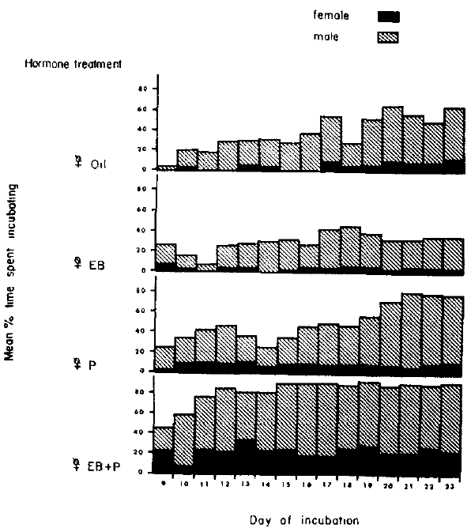
Estrogen and progesterone facilitate female incubation
Incubation is sustained contact with eggs during their development. Cheng and Silver introduced infertile eggs under a controlled schedule and recorded the fraction of observation time spent sitting, comparing the four hormone conditions after ovariectomy. The infertile eggs were introduced under a schedule that stayed the same across the four hormone conditions.
Combined estrogen and progesterone most effectively restored incubation in females. Estrogen alone, progesterone alone and vehicle produced weaker early responses, even though all groups had access to the same nest setting and experimental eggs. Vehicle and single-hormone groups provide the baseline against which the combined effect is measured.
Hormone replacement altered how readily the females responded within a setting that already contained eggs, a nest and a partner. The incubation response therefore depends on the endocrine state together with these sensory and social components. The eggs, nest and partner form a context in which the hormone state adjusts the level of incubation.
Cheng & Silver (1975), Fig. 2. Daily incubation time in each female hormone condition.
Cheng & Silver (1975)
11
Notes:
Incubation is sustained contact with eggs during their development. Cheng and Silver introduced infertile eggs under a controlled schedule and recorded the fraction of observation time spent sitting, comparing the four hormone conditions after ovariectomy.
Combined estrogen and progesterone most effectively restored incubation in females. Estrogen alone, progesterone alone and vehicle produced different, generally weaker early responses, despite access to the same breeding setting and experimental eggs.
Eggs and a nest were parts of the preparation. Hormone replacement altered responsiveness within this sensory and social context; the experiment does not establish an endocrine command that produces normal incubation independently of an appropriate nest, eggs or partner.
References:
Cheng MF, Silver R (1975). Estrogen-progesterone regulation of nest-building and incubation behavior in ovariectomized ring doves (Streptopelia risoria). Journal of Comparative and Physiological Psychology 88:256–263. https://doi.org/10.1037/h0076181
Figure sources:
Cheng & Silver (1975), Fig. 2. Daily incubation time in each female hormone condition. https://doi.org/10.1037/h0076181

Slide 15
Untreated males respond to the female’s endocrine state
In Cheng and Silver's preparation, males were intact and received no experimental steroid treatment. Their mates differed in estrogen and progesterone replacement, which made it possible to test whether changing one animal's endocrine state altered another animal's behavior. Males were intact and untreated, so any change in their behavior came from their mates rather than from their own hormones.
Males paired with females receiving the combined regimen began incubating more readily early in the observation period. The difference concerned the timing and distribution of sitting, while overall incubation across the full period was similar among male groups. The sitting measures were compared day by day, which shows when the male differences appeared.
A partner effect is distinct from a direct pharmacological effect. Male responses may depend on female actions, competition or coordination at the nest, and on the availability of sitting opportunities. The experiment did not measure a specific male endocrine intermediary. Male sitting responds to the female's state through the opportunities and cues that the pair creates at the nest.
Cheng & Silver (1975), Fig. 2. Daily incubation time in each female hormone condition.
Cheng & Silver (1975)
12
Notes:
In Cheng and Silver’s preparation, males were intact and received no experimental steroid treatment. Their mates differed in estrogen and progesterone replacement, enabling a test of whether manipulating one animal’s endocrine state changes another animal’s behavior.
Males paired with females receiving the combined regimen began incubating more readily early in the observation period. The difference concerned the timing and distribution of sitting; overall incubation duration across the full period was not clearly different among male groups.
A partner effect is therefore distinct from a direct pharmacological effect. Male responses may depend on female actions, competition or coordination at the nest, and changing availability of sitting opportunities. The experiment did not measure a specific male endocrine intermediary.
References:
Cheng MF, Silver R (1975). Estrogen-progesterone regulation of nest-building and incubation behavior in ovariectomized ring doves (Streptopelia risoria). Journal of Comparative and Physiological Psychology 88:256–263. https://doi.org/10.1037/h0076181
Figure sources:
Cheng & Silver (1975), Fig. 2. Daily incubation time in each female hormone condition. https://doi.org/10.1037/h0076181

Slide 16
Construction requires more than picking up material
Cheng and Silver separated picking up and dropping nest material, carrying it to a site, and tucking it into the nest bowl. These measures distinguish interaction with an available object from the coordinated construction needed for a functional nest. Each action is scored separately, so the tucking and carrying measures can be compared across the same pairs.
Females given the combined regimen more reliably performed the later construction actions than females given either hormone alone or oil. Records of untreated males allowed each partner's contribution to be measured separately. The later construction actions were most reliable in the combined-regimen females.
On days 8 and 10, pairs lacking completed nests received an experimenter-built nest. Tucking material into that nest therefore involved rearranging an existing structure rather than constructing a new one. Pairs without a completed nest were provided with one, which made the tucking measure reflect rearrangement.
Cheng & Silver (1975), Fig. 2. Daily incubation time in each female hormone condition.
Cheng & Silver (1975)
12a
Notes:
Construction requires more than picking up material.
Explanation 1.
Cheng and Silver separated picking up and dropping nest material, carrying it to a site, and tucking it into the nest bowl
These measures distinguish interaction with an available object from the coordinated construction needed for a functional nest. Each action is scored separately, so the tucking and carrying measures can be compared across the same pairs.
Explanation 2.
Females given the combined regimen more reliably performed the later construction actions than females given either hormone alone or oil
Records of untreated males allowed each partner's contribution to be measured separately. The later construction actions were most reliable in the combined-regimen females.
Explanation 3.
On days 8 and 10, pairs lacking completed nests received an experimenter-built nest
Tucking material into that nest therefore involved rearranging an existing structure rather than constructing a new one. Pairs without a completed nest were provided with one, which made the tucking measure reflect rearrangement.
Source.
The figure and the measurements come from Cheng & Silver (1975).
Each statement is tied to the recordings or observations of that study.
References:
Cheng MF, Silver R (1975). Estrogen-progesterone regulation of nest-building and incubation behavior in ovariectomized ring doves (Streptopelia risoria). Journal of Comparative and Physiological Psychology 88:256–263. https://doi.org/10.1037/h0076181

Slide 17
Hormones change readiness within a breeding context
Estradiol is an estrogenic steroid, and progesterone is another ovarian steroid involved in reproductive state. Their combined replacement restored nest building and incubation more effectively than either steroid alone in experienced ovariectomized ring doves. Estradiol and progesterone were tested separately and together, so the combined effect is measured alongside each steroid alone.
The treatment operated in a preparation containing an untreated mate, nesting material, a nest and introduced eggs. Courtship, construction and sitting were measured separately, because one hormone condition can affect each component in a different way. The preparation included the mate, the materials and the eggs, so each treatment worked within a full breeding context.
Systemic injection establishes a causal endocrine contribution to behavior under defined conditions. Receptor locations within a particular brain nucleus and the split between neural and peripheral actions are left to other experiments, and the complete normal hormone sequence remains to be mapped. Systemic injection therefore reveals endocrine effects on the whole behavioral sequence of the female.
Cheng & Silver (1975), Fig. 1. Daily nest building by treated females and untreated males.
Cheng & Silver (1975), Fig. 2. Daily incubation time in each female hormone condition.
Cheng & Silver (1975)
13
Notes:
Estradiol is an estrogenic steroid, and progesterone is another ovarian steroid involved in reproductive state. Their combined replacement restored nest building and incubation more effectively than either steroid alone in experienced ovariectomized ring doves.
The treatment operated in a preparation containing an untreated mate, nesting material, a nest and introduced eggs. Courtship, construction and sitting were measured separately because one hormone condition need not affect every component in the same way.
These systemic injections do not locate the relevant receptors in a particular brain nucleus or separate neural from peripheral actions. They establish a causal endocrine contribution to behavior under defined conditions, while leaving the cellular pathway and the complete normal hormone sequence unresolved.
References:
Cheng MF, Silver R (1975). Estrogen-progesterone regulation of nest-building and incubation behavior in ovariectomized ring doves (Streptopelia risoria). Journal of Comparative and Physiological Psychology 88:256–263. https://doi.org/10.1037/h0076181
Figure sources:
Cheng & Silver (1975), Fig. 1. Daily nest building by treated females and untreated males. https://doi.org/10.1037/h0076181
Cheng & Silver (1975), Fig. 2. Daily incubation time in each female hormone condition. https://doi.org/10.1037/h0076181

Slide 18
Muting separates vocal output from social contact
Cheng tested whether a female's own vocal behavior contributes to reproductive development. A reversible peripheral muting procedure prevented normal sound production, so females could still interact with courting males while experimental playback supplied controlled auditory input. Muting removed the female's vocal output, while her hearing and social contact with the male remained intact.
Devocalization prevents vocal sound production but leaves hearing intact. Sham-operated females controlled for the procedure, and muted females heard their own coos, male coos, another female's coos, or no playback. The playback conditions tested which sounds carry the reproductive effect in the muted female.
Pairs interacted for 2 hours daily over 5 days. Keeping male contact present reduced the chance that poor development resulted from social isolation, and the female's altered vocal output still shaped the details of the reciprocal interaction. Pairs met daily, so the social setting was held constant across all the muting conditions.
Cheng (1986), Fig. 1(a,b). Female and male ring-dove nest-coo sonograms.
Cheng (1986)
14
Notes:
Cheng tested whether a female’s own vocal behavior contributes to reproductive development. A reversible peripheral muting procedure prevented normal sound production, permitting females to interact with courting males while experimental playback supplied controlled auditory input.
Devocalization means preventing vocal sound production; it does not mean removing the animal’s hearing. Sham-operated females controlled for the procedure, and muted females heard their own coos, male coos, another female’s coos, or no playback.
Pairs interacted for 2 hours daily over 5 days. Keeping male contact present reduced the possibility that poor development simply resulted from social isolation, although altered female output could still change details of the reciprocal interaction.
References:
Cheng MF (1986). Female cooing promotes ovarian development in ring doves. Physiology & Behavior 37:371–374. https://doi.org/10.1016/0031-9384(86)90248-9
Figure sources:
Cheng (1986), Fig. 1(a,b). Female and male ring-dove nest-coo sonograms. https://doi.org/10.1016/0031-9384(86)90248-9

Slide 19
Self-produced calls provide endocrine feedback
Acoustic feedback is hearing sound generated by one's own behavior. Cheng recorded female nest-coos before muting and played those calls back during pairing, restoring auditory input without restoring normal vocal sound production. Playback was delivered during pairing, so the female heard the calls while she was in contact with her partner.
The diameter of the same dominant ovarian follicle was measured before and after the playback period. A follicle is the developing egg and its surrounding tissue, and the initial diameters were 4–5 millimeters across treatment conditions. The follicle is measured before and after the same playback period, which makes each animal its own control.
Own-call playback produced substantially more growth than male-call playback. This rescue supports an auditory contribution from the female's own display, and the intervening neural circuit is the link to identify. The growth after own-call playback exceeded that after male-call playback, which points to the female's own display.
Cheng (1986), Fig. 1(a,b). Female and male ring-dove nest-coo sonograms.
Cheng (1986)
15
Notes:
Acoustic feedback is hearing sound generated by one’s own behavior. Cheng recorded female nest-coos before muting and played those calls back during pairing, allowing auditory input to be restored without restoring normal vocal sound production.
The diameter of the same dominant ovarian follicle was measured before and after the playback period. A follicle is the developing egg and its surrounding tissue; the initial measured diameters were 4–5 millimeters across treatment conditions.
Own-call playback produced substantially more growth than male-call playback. This rescue supports an auditory contribution from the female’s own display, but does not identify the intervening neural circuit or prove that motor and bodily feedback make no contribution during natural cooing.
References:
Cheng MF (1986). Female cooing promotes ovarian development in ring doves. Physiology & Behavior 37:371–374. https://doi.org/10.1016/0031-9384(86)90248-9
Figure sources:
Cheng (1986), Fig. 1(a,b). Female and male ring-dove nest-coo sonograms. https://doi.org/10.1016/0031-9384(86)90248-9

Slide 20
Acoustic feedback restores follicular growth
Cheng recorded female nest-coos before muting and played those calls back during pairing. Auditory input was restored while normal vocal sound production stayed impaired, which isolates hearing from vocal output. The muting procedure is reversible, so the same females can be tested under different playback conditions.
The diameter of the same dominant ovarian follicle was measured before and after the playback period. The initial diameters were 4–5 millimeters across treatment conditions, so each change is measured from a common starting point. The follicle diameters were compared between the own-call, male-call and no-playback groups.
Own-call playback produced substantially more growth than male-call playback. The rescue supports an auditory contribution from the female's own display, and the neural circuit carrying that signal is the link still to be identified. Own-call playback produced the largest growth in the muted females.
Cheng (1986), Fig. 1(a,b). Female and male ring-dove nest-coo sonograms.
Cheng (1986)
15a
Notes:
Acoustic feedback restores follicular growth.
Explanation 1.
Cheng recorded female nest-coos before muting and played those calls back during pairing
Auditory input was restored while normal vocal sound production stayed impaired, which isolates hearing from vocal output. The muting procedure is reversible, so the same females can be tested under different playback conditions.
Explanation 2.
The diameter of the same dominant ovarian follicle was measured before and after the playback period
The initial diameters were 4–5 millimeters across treatment conditions, so each change is measured from a common starting point. The follicle diameters were compared between the own-call, male-call and no-playback groups.
Explanation 3.
Own-call playback produced substantially more growth than male-call playback
The rescue supports an auditory contribution from the female's own display, and the neural circuit carrying that signal is the link still to be identified. Own-call playback produced the largest growth in the muted females.
Source.
The figure and the measurements come from Cheng (1986).
Each statement is tied to the recordings or observations of that study.
References:
Cheng MF (1986). Female cooing promotes ovarian development in ring doves. Physiology & Behavior 37:371–374. https://doi.org/10.1016/0031-9384(86)90248-9

Slide 21
Own-call playback restores follicular growth
Cheng reported a mean follicular diameter increase of 6.8 millimeters in muted females that heard their own coos. The increase was 2.1 millimeters with male coos and 1.7 millimeters without playback, while sham females increased by 6.5 millimeters. Each condition is summarized by the mean increase in diameter, so the groups can be compared directly.
These values are changes in diameter, not final follicular diameters or rates per day. Before and after measurements of the same dominant follicle linked the acoustic treatment to a physical reproductive response during the 5-day pairing procedure. The before-and-after design links each animal's acoustic treatment to its own follicle.
The own-call condition approached the sham response even though the females remained muted. Playback therefore supplied an effective component of the missing display, while the complete pituitary hormone sequence connecting sound to follicular growth remains to be measured. The sham females increased by 6.5 millimeters, so the muted-own-call result approached the normal growth response.
Cheng (1986), Fig. 1(a,b). Female and male ring-dove nest-coo sonograms.
Cheng (1986)
16
Notes:
Cheng reported a mean follicular diameter increase of 6.8 millimeters in muted females hearing their own coos. The corresponding increase was 2.1 millimeters with male coos and 1.7 millimeters without playback; sham females increased by 6.5 millimeters.
These are reported changes in diameter, rather than final follicular diameters or rates per day. Before and after measurements of the same dominant follicle connected the acoustic treatment to a physical reproductive response during the 5-day pairing procedure.
The own-call condition approached the sham response despite continued muting. Playback therefore supplied a physiologically effective component of the missing display, although the experiment did not measure the complete pituitary hormone sequence connecting sound to follicular growth.
References:
Cheng MF (1986). Female cooing promotes ovarian development in ring doves. Physiology & Behavior 37:371–374. https://doi.org/10.1016/0031-9384(86)90248-9
Figure sources:
Cheng (1986), Fig. 1(a,b). Female and male ring-dove nest-coo sonograms. https://doi.org/10.1016/0031-9384(86)90248-9

Slide 22
Other female calls can also stimulate development
Muted females hearing another female's nest-coos showed a mean follicular diameter increase of 4.7 millimeters in Cheng's experiment. Own-call playback produced 6.8 millimeters, whereas male-call playback produced 2.1 millimeters under the same general pairing procedure. The same pairing procedure was used for the other female's calls and for the male calls, which keeps the procedure constant.
The result shows that the effect is not restricted to recognizing one's own unique voice. Female call characteristics can carry an effective stimulus even when the recording comes from a different individual. The response to another female's calls shows that the effect extends to other female calls.
The paper considered acoustic differences between female and male nest-coos, and the original sonograms document the supplied call classes. The specific auditory feature and the receptor that respond to it define the open part of this system. The sonograms record the call classes that the females heard, which defines the stimuli used in the test.
Cheng (1986), Fig. 1(a,b). Female and male ring-dove nest-coo sonograms.
Cheng (1986)
17
Notes:
Muted females hearing another female’s nest-coos showed a mean follicular diameter increase of 4.7 millimeters in Cheng’s experiment. Own-call playback produced 6.8 millimeters, whereas male-call playback produced only 2.1 millimeters under the same general pairing procedure.
The result prevents treating the effect as an all-or-none requirement for recognizing one’s unique voice. Female call characteristics can carry an effective stimulus even when the recording comes from a different individual.
The paper considered acoustic differences between female and male nest-coos, but did not isolate each acoustic feature with synthetic stimuli. The original sonograms document the supplied call classes; they do not establish the precise auditory feature or receptor responsible for the reproductive response.
References:
Cheng MF (1986). Female cooing promotes ovarian development in ring doves. Physiology & Behavior 37:371–374. https://doi.org/10.1016/0031-9384(86)90248-9
Figure sources:
Cheng (1986), Fig. 1(a,b). Female and male ring-dove nest-coo sonograms. https://doi.org/10.1016/0031-9384(86)90248-9

Slide 23
Auditory rescue does not exclude bodily feedback
Cheng distinguished hearing a nest-coo from proprioceptive feedback, the sensory information that comes from performing the movements of a vocal display. Playback to muted females restored an auditory stimulus while normal sound production stayed impaired. Proprioception is sensory feedback from the body, and it contributes to the sense of performing a movement.
The strong own-call response supports an acoustic route, and playback can also provoke attempted vocal movements and their bodily signals. Auditory rescue therefore engages the auditory route, and the motor and sensory consequences of calling are distinct from it. The muted females heard the calls while their sound production remained impaired, which distinguishes the two routes.
The normal reproductive sequence contains reciprocal links: courtship promotes female behavior, and that behavior stimulates the female herself. The measured endpoint was follicular growth, and the neurons, synapses and hormone release events that mediate each link are the targets for identifying the mechanism. The sequence therefore has a loop: courtship drives the female's behavior, and her behavior feeds back on her physiology.
Cheng (1986), Fig. 1(a,b). Female and male ring-dove nest-coo sonograms.
Cheng (1986)
18
Notes:
Cheng distinguished hearing a nest-coo from proprioceptive feedback, sensory information associated with performing the movements of a vocal display. Playback to muted females restored an auditory stimulus while leaving normal sound production impaired.
The strong own-call response supports an acoustic route, but playback can also provoke attempted vocal movements and associated bodily signals. Consequently, auditory rescue is not equivalent to holding every motor and sensory consequence of calling constant.
The normal reproductive sequence can contain reciprocal links: courtship promotes female behavior, and that behavior supplies further stimulation to the female herself. The measured endpoint was follicular growth; the experiment did not directly record the neurons, synapses or hormone release events mediating each link.
References:
Cheng MF (1986). Female cooing promotes ovarian development in ring doves. Physiology & Behavior 37:371–374. https://doi.org/10.1016/0031-9384(86)90248-9
Figure sources:
Cheng (1986), Fig. 1(a,b). Female and male ring-dove nest-coo sonograms. https://doi.org/10.1016/0031-9384(86)90248-9

Slide 24
Hearing and bodily feedback are distinct inputs
Cheng distinguished hearing a nest-coo from proprioceptive feedback, which is sensory information from performing the movements of a vocal display. Playback restored the auditory stimulus while the muted females' sound production stayed impaired. Proprioceptive feedback comes from the movements that produce the call, not from the sound it makes.
Playback can also provoke attempted vocal movements and their bodily signals. Auditory rescue therefore engages one route, and the motor and sensory consequences of calling form a separate route. Playback restored the sound the female heard, so the auditory route was tested alone.
Courtship promotes female behavior, and that behavior stimulates the female herself. This reciprocal link makes the reproductive sequence a loop, with follicular growth as the measured endpoint. Reproductive growth in the females therefore depends on both auditory and bodily signals.
Cheng (1986), Fig. 1(a,b). Female and male ring-dove nest-coo sonograms.
Cheng (1986)
18a
Notes:
Hearing and bodily feedback are distinct inputs.
Explanation 1.
Cheng distinguished hearing a nest-coo from proprioceptive feedback, which is sensory information from performing the movements of a vocal display
Playback restored the auditory stimulus while the muted females' sound production stayed impaired. Proprioceptive feedback comes from the movements that produce the call, not from the sound it makes.
Explanation 2.
Playback can also provoke attempted vocal movements and their bodily signals
Auditory rescue therefore engages one route, and the motor and sensory consequences of calling form a separate route. Playback restored the sound the female heard, so the auditory route was tested alone.
Explanation 3.
Courtship promotes female behavior, and that behavior stimulates the female herself
This reciprocal link makes the reproductive sequence a loop, with follicular growth as the measured endpoint. Reproductive growth in the females therefore depends on both auditory and bodily signals.
Source.
The figure and the measurements come from Cheng (1986).
Each statement is tied to the recordings or observations of that study.
References:
Cheng MF (1986). Female cooing promotes ovarian development in ring doves. Physiology & Behavior 37:371–374. https://doi.org/10.1016/0031-9384(86)90248-9

Slide 25
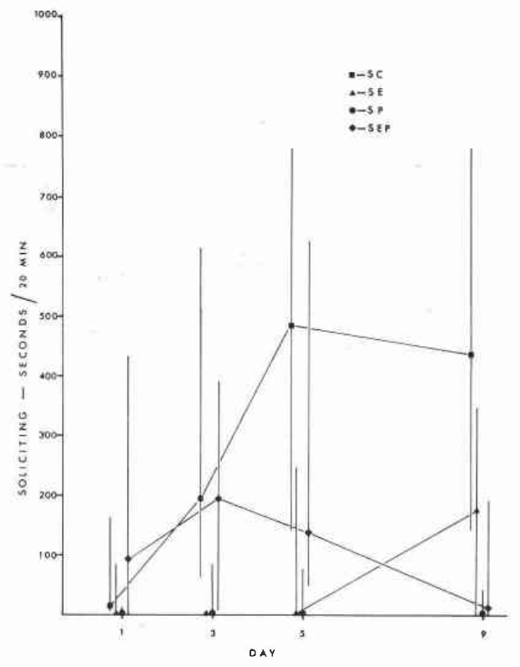
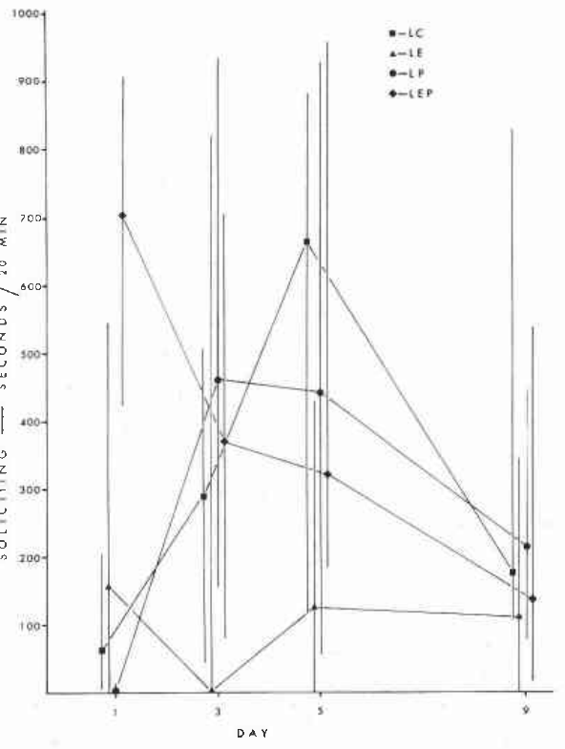
Photoperiod changes responsiveness to progesterone
Liley tested females that interacted with males for 4 hours daily across 9 observation days, under short and long photoperiods. Progesterone-treated females showed little soliciting under short days but increased their activity rapidly under long days, despite receiving the same administered hormone. Liley's light schedules differed in day length, while the number of observation days stayed the same for each group.
Control females differed little in egg laying, courtship or nest building between the two light schedules. The photoperiod effect therefore depended on the hormone treatment and the behavioral context, and it operated through that treatment. Progesterone treatment changed behavior only through its interaction with the day length, which defines the response.
Photoperiod and hormone together determine how strongly the female responds to the breeding setting. The same hormone produced different outcomes under different day lengths, which makes light an essential part of the response. The photoperiod and the hormone together set how strongly each female responds to the breeding setting.
Liley (1976), Fig. 2. Female soliciting under a 16-hour photoperiod.
Liley (1976), Fig. 1. Female soliciting under an 8-hour photoperiod.
Liley (1976)
19
Notes:
Photoperiod is the daily duration of light exposure. Liley housed intact female ring doves under 8-hour or 16-hour light periods, administered saline or steroid treatments for 15 days, and introduced reproductively active males after 7 days of treatment.
Females interacted with males for 4 hours daily across 9 observation days. Progesterone-treated females showed little soliciting under short days but increased activity rapidly under long days, despite receiving the same class of administered hormone.
Control females did not differ clearly in egg laying, courtship or nest building between these light schedules. The photoperiod effect therefore depended on treatment and behavioral context, rather than establishing a universal enhancement of all reproductive behavior whenever daylight is extended.
References:
Liley NR (1976). The role of estrogen and progesterone in the regulation of reproductive behaviour in female ring doves (Streptopelia risoria) under long vs. short photoperiods. Canadian Journal of Zoology 54:1409–1422. https://doi.org/10.1139/z76-164
Figure sources:
Liley (1976), Fig. 1. Female soliciting under an 8-hour photoperiod. https://doi.org/10.1139/z76-164
Liley (1976), Fig. 2. Female soliciting under a 16-hour photoperiod. https://doi.org/10.1139/z76-164

Slide 26
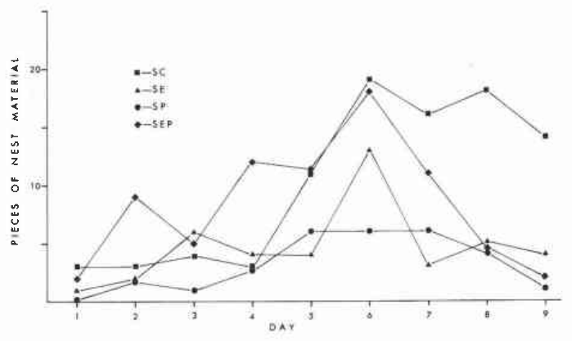
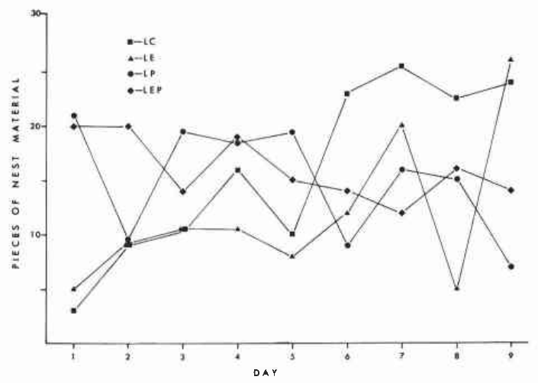
Long days facilitate hormone-dependent nest activity
Liley measured nest-material accumulation as well as female soliciting. Under 16-hour days, progesterone-treated pairs built more actively than in the corresponding 8-hour condition, and estrogen-containing treatments also supported substantial nest-oriented activity. The nest-material counts were taken over the 9 days after male introduction, which fixes the period of measurement.
Nest material was counted across the 9-day period after male introduction. Both partners contribute to construction, so the accumulated material is a pair-level output, while the duration of female soliciting identifies one animal's behavior. Pair-level material and female-level soliciting measure different outputs of the same breeding context.
Long-day treatment modified the response to the steroid conditions. The pair-level difference reflects the combined activity of both birds, and it points to a change in how the pair organizes nest building under long days. The change in pair organization under long days depends on the hormone condition applied to the female.
Liley (1976), Fig. 3. Nest-material accumulation under short days.
Liley (1976), Fig. 4. Nest-material accumulation under long days.
Liley (1976)
20
Notes:
Liley measured nest-material accumulation as well as female soliciting. Under 16-hour days, progesterone-treated pairs built more actively than the corresponding 8-hour condition; estrogen-containing treatments also supported substantial nest-oriented activity.
Nest material was counted across the 9-day period after male introduction. Because both partners contribute to construction, the accumulated material is a pair-level output, whereas duration of female soliciting identifies a particular animal’s behavior.
Long-day treatment modified responsiveness to the steroid conditions, but did not isolate a single light-sensitive neural pathway. The observed pair-level difference should not be interpreted as a direct measurement of one female motor circuit or as proof that a particular receptor changed abundance.
References:
Liley NR (1976). The role of estrogen and progesterone in the regulation of reproductive behaviour in female ring doves (Streptopelia risoria) under long vs. short photoperiods. Canadian Journal of Zoology 54:1409–1422. https://doi.org/10.1139/z76-164
Figure sources:
Liley (1976), Fig. 3. Nest-material accumulation under short days. https://doi.org/10.1139/z76-164
Liley (1976), Fig. 4. Nest-material accumulation under long days. https://doi.org/10.1139/z76-164

Slide 27
Steroid treatment does not recreate every reproductive act
Liley's estrogen and combined estrogen–progesterone treatments supported female soliciting and nest-building activity, with greater nest-oriented activity generally occurring under long days. Begging and sexual crouching associated with copulation remained infrequent in the hormone-treated birds. The estrogen and combined treatments both produced nest-oriented activity under long days, which defines the common response.
Treatment lasted 15 days and was combined with daily access to an active male. Each reproductive action was recorded separately, so the results describe specific behaviors rather than a single global judgment of breeding condition. The observations were made on the daily access schedule, so the frequency of each action is comparable across birds.
Hormonal facilitation is behavior-specific. A treatment can promote nest-directed activity without restoring the complete sequence of mating and egg laying, and this pattern applies to intact females of the species tested. Copulation and egg laying are separate actions, and this treatment left both infrequent in these birds.
Liley (1976), Fig. 2. Female soliciting under a 16-hour photoperiod.
Liley (1976)
21
Notes:
Liley’s estrogen and combined estrogen–progesterone treatments supported female soliciting and nest-building activity, with greater nest-oriented activity generally occurring under long days. Yet begging and sexual crouching associated with copulation remained infrequent in the hormone-treated birds.
Treatment lasted 15 days and was combined with daily access to an active male. Different reproductive actions were recorded separately, rather than inferred from a single global judgment that a bird was in breeding condition.
Hormonal facilitation is therefore behavior-specific. A treatment can promote nest-directed activity without restoring the complete sequence of mating and egg laying. These findings concern intact females and should not be assumed to match the replacement requirements of ovariectomized females exactly.
References:
Liley NR (1976). The role of estrogen and progesterone in the regulation of reproductive behaviour in female ring doves (Streptopelia risoria) under long vs. short photoperiods. Canadian Journal of Zoology 54:1409–1422. https://doi.org/10.1139/z76-164
Figure sources:
Liley (1976), Fig. 2. Female soliciting under a 16-hour photoperiod. https://doi.org/10.1139/z76-164

Slide 28
Hormones promote nest activity while copulation stays rare
Liley's estrogen and combined estrogen–progesterone treatments supported female soliciting and nest-building activity. Nest-oriented activity was greatest under long days, while begging and sexual crouching stayed infrequent in the hormone-treated birds. The estrogen and combined treatments both promoted nest-directed activity under long days.
The treatment lasted 15 days and was combined with daily access to an active male. Each reproductive action was recorded separately, so the results describe specific behaviors rather than a single judgment of breeding condition. Each action category was counted, so begging and crouching are reported on their own.
Hormonal facilitation is behavior-specific. A treatment can promote nest-directed activity while the full sequence of mating and egg laying remains infrequent, and this pattern was observed in intact females. Hormone treatment shapes which reproductive actions the female performs in an intact context.
Liley (1976), Fig. 2. Female soliciting under a 16-hour photoperiod.
Liley (1976)
21a
Notes:
Hormones promote nest activity while copulation stays rare.
Explanation 1.
Liley's estrogen and combined estrogen–progesterone treatments supported female soliciting and nest-building activity
Nest-oriented activity was greatest under long days, while begging and sexual crouching stayed infrequent in the hormone-treated birds. The estrogen and combined treatments both promoted nest-directed activity under long days.
Explanation 2.
The treatment lasted 15 days and was combined with daily access to an active male
Each reproductive action was recorded separately, so the results describe specific behaviors rather than a single judgment of breeding condition. Each action category was counted, so begging and crouching are reported on their own.
Explanation 3.
Hormonal facilitation is behavior-specific
A treatment can promote nest-directed activity while the full sequence of mating and egg laying remains infrequent, and this pattern was observed in intact females. Hormone treatment shapes which reproductive actions the female performs in an intact context.
Source.
The figure and the measurements come from Liley (1976).
Each statement is tied to the recordings or observations of that study.
References:
Liley NR (1976). The role of estrogen and progesterone in the regulation of reproductive behaviour in female ring doves (Streptopelia risoria) under long vs. short photoperiods. Canadian Journal of Zoology 54:1409–1422. https://doi.org/10.1139/z76-164

Slide 29
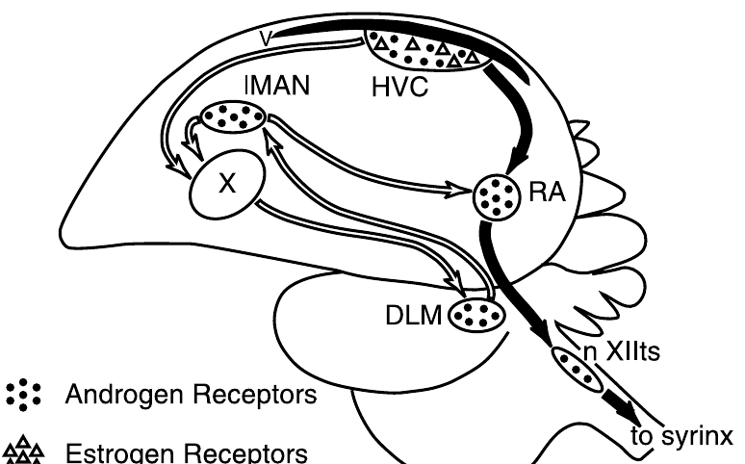
Canary song nuclei differ between spring and autumn
HVC is a song-control nucleus, which is an anatomically defined collection of neurons. RA, the robust nucleus of the arcopallium, receives motor-pathway input from HVC and projects toward the brainstem circuitry that controls vocal production. HVC and RA are two stages of the vocal motor pathway, with HVC sending input to RA in the descending path.
Nottebohm compared adult male canaries in spring and autumn. HVC was about 99 percent larger in spring, and RA was roughly three-quarters larger, which established substantial seasonal differences in adult brain anatomy. The spring and autumn groups were examined at different times of the year, so the seasonal difference is the variable.
The pathway drawing is the published sparrow anatomy from Tramontin and colleagues, not a canary reconstruction. Nottebohm's seasonal groups were different animals examined after death, so the result documents seasonal plasticity across groups. The drawing comes from the sparrow study, so the anatomy is shared across these two songbird species.
Tramontin et al. (2000), Fig. 1. Published song pathways and steroid-receptor distribution.
Nottebohm (1981); Tramontin et al. (2000)
22
Notes:
HVC is a proper name for a song-control nucleus; a nucleus is an anatomically defined collection of neurons. RA, the robust nucleus of the arcopallium, receives motor-pathway input from HVC and projects toward the brainstem circuitry controlling vocal production.
Nottebohm compared adult male canaries in spring and autumn. HVC was approximately 99 percent larger in spring, and RA was roughly three-quarters larger, establishing substantial seasonal differences in adult brain anatomy.
The pathway drawing is the original published sparrow anatomy from Tramontin and colleagues, not a canary reconstruction. Nottebohm’s seasonal groups were different animals examined after death; the comparison supports seasonal plasticity but is not repeated imaging of one animal’s annual cycle.
References:
Nottebohm F (1981). A brain for all seasons: Cyclical anatomical changes in song control nuclei of the canary brain. Science 214:1368–1370. https://doi.org/10.1126/science.7313697
Tramontin AD, Hartman VN, Brenowitz EA (2000). Breeding conditions induce rapid and sequential growth in adult avian song control circuits: A model of seasonal plasticity in the brain. Journal of Neuroscience 20:854–861. https://doi.org/10.1523/JNEUROSCI.20-02-00854.2000
Figure sources:
Tramontin et al. (2000), Fig. 1. Published song pathways and steroid-receptor distribution. https://doi.org/10.1523/JNEUROSCI.20-02-00854.2000

Slide 30
Seasonal androgens covary with song-system anatomy
Androgens are steroid hormones that include testosterone and influence reproductive physiology. Nottebohm reported spring serum androgen concentrations of 1.65 nanograms per milliliter, against 0.13 nanograms per milliliter in the autumn canaries. Androgens act on the same reproductive system that controls the seasonal growth of the song nuclei.
The larger spring HVC and RA coincided with the higher circulating hormone concentrations. Comparisons normalized to a reference brain region retained substantial seasonal differences, which makes uniform enlargement of the whole brain an unlikely explanation. The reference region is a brain area outside the song system, so it shows whether the whole brain changed.
Season and hormone level covary in these animals, so their association points to a link between androgens and song-nucleus anatomy. A change in nucleus size alone shows the outcome, and cellular measures show whether neurons were added, enlarged or remodeled. Season and hormone level therefore point to a shared cause for both the hormone change and the anatomical change.
Tramontin et al. (2000), Fig. 1. Published song pathways and steroid-receptor distribution.
Nottebohm (1981); Tramontin et al. (2000)
23
Notes:
Androgens are steroid hormones that include testosterone and influence reproductive physiology. Nottebohm reported spring serum androgen concentrations of 1.65 nanograms per milliliter, compared with 0.13 nanograms per milliliter in the autumn canaries.
The larger spring HVC and RA coincided with the higher circulating hormone concentrations. Comparisons normalized to a reference brain region also retained substantial seasonal differences, reducing the likelihood that uniform enlargement of the entire brain explains the result.
Season and hormone level were not independently assigned in this comparison. Their association cannot alone establish that testosterone caused the anatomical change, and a larger nucleus cannot reveal whether neurons were added, cells enlarged or connections remodeled without additional cellular measurements.
References:
Nottebohm F (1981). A brain for all seasons: Cyclical anatomical changes in song control nuclei of the canary brain. Science 214:1368–1370. https://doi.org/10.1126/science.7313697
Tramontin AD, Hartman VN, Brenowitz EA (2000). Breeding conditions induce rapid and sequential growth in adult avian song control circuits: A model of seasonal plasticity in the brain. Journal of Neuroscience 20:854–861. https://doi.org/10.1523/JNEUROSCI.20-02-00854.2000
Figure sources:
Tramontin et al. (2000), Fig. 1. Published song pathways and steroid-receptor distribution. https://doi.org/10.1523/JNEUROSCI.20-02-00854.2000

Slide 31
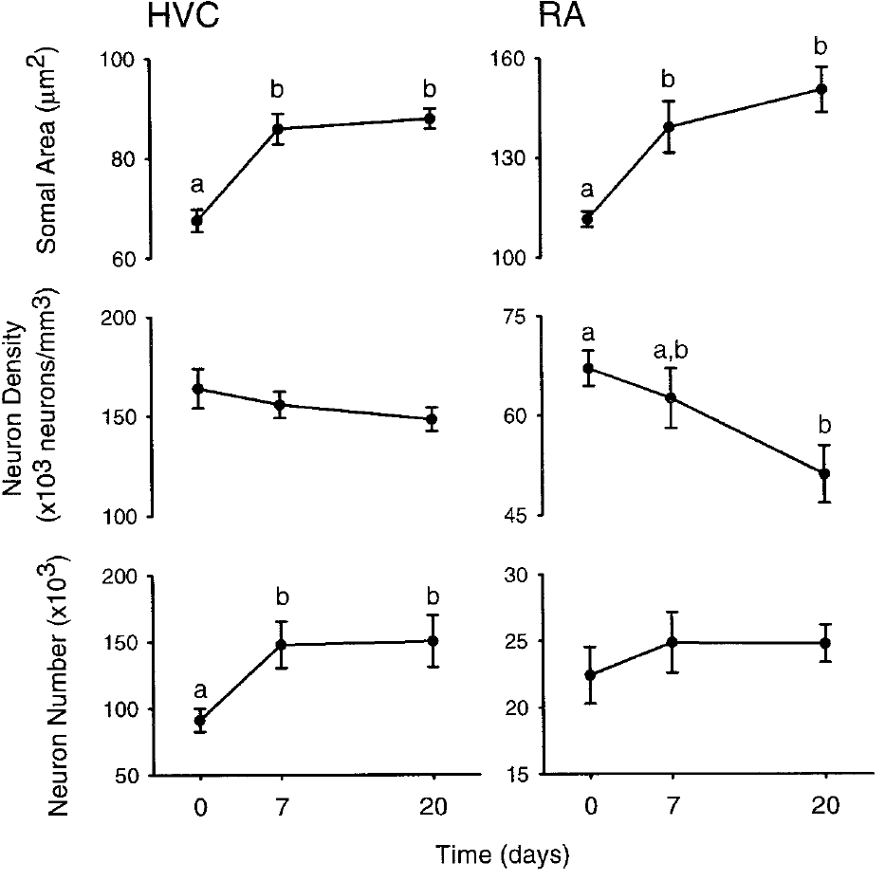
Seasonal volume changes require cellular explanation
Neural plasticity is a change in nervous-system structure or function with state or experience. Nottebohm's canary measurements established seasonal variation in song-nucleus volume, and that volume combines the contributions of neurons, their processes and other tissue components. Volume is an anatomical measure, and seasonal changes in volume can come from several cellular sources.
A seasonal increase therefore reflects a change in tissue volume that can arise from several cellular processes. Histological measurements separate cell size, cell density and cell number, while recordings and behavioral assays address the consequences for vocal output. Cell size, cell density and cell number each measure a different contributor to the total volume.
Tramontin and colleagues measured these attributes in white-crowned sparrows exposed to controlled breeding-like conditions. Their cellular results provide an experimental comparison across species, and they supply the cellular detail that the canary volume data lacked. The sparrow results were gathered under controlled conditions, so they give a clear cellular account for the seasonal growth.
Tramontin et al. (2000), Fig. 1. Published song pathways and steroid-receptor distribution.
Tramontin et al. (2000), Fig. 4. Soma size, neuron density and neuron number in HVC and RA.
Nottebohm (1981); Tramontin et al. (2000)
24
Notes:
Neural plasticity is a change in nervous-system structure or function with state or experience. Nottebohm’s canary measurements established seasonal variation in song-nucleus volume, but volume combines contributions from neurons, their processes and other tissue components.
A seasonal increase therefore cannot automatically be called neuron birth or stronger synaptic transmission. Histological measurements must distinguish cell size, cell density and cell number, while recordings or behavioral assays address consequences for vocal output.
Tramontin and colleagues later measured these attributes in white-crowned sparrows exposed to controlled breeding-like conditions. Their cellular results provide an experimental comparison across species; they do not retrospectively identify every process responsible for the original canary differences.
References:
Nottebohm F (1981). A brain for all seasons: Cyclical anatomical changes in song control nuclei of the canary brain. Science 214:1368–1370. https://doi.org/10.1126/science.7313697
Tramontin AD, Hartman VN, Brenowitz EA (2000). Breeding conditions induce rapid and sequential growth in adult avian song control circuits: A model of seasonal plasticity in the brain. Journal of Neuroscience 20:854–861. https://doi.org/10.1523/JNEUROSCI.20-02-00854.2000
Figure sources:
Tramontin et al. (2000), Fig. 1. Published song pathways and steroid-receptor distribution. https://doi.org/10.1523/JNEUROSCI.20-02-00854.2000
Tramontin et al. (2000), Fig. 4. Soma size, neuron density and neuron number in HVC and RA. https://doi.org/10.1523/JNEUROSCI.20-02-00854.2000

Slide 32
Volume changes call for cellular measures
Neural plasticity is a change in nervous-system structure or function with state or experience. Nottebohm's measurements established seasonal variation in song-nucleus volume, and that volume combines neurons, their processes and other tissue components. The canary volume measures were taken from adult birds in different seasons.
A seasonal increase can reflect cell size, cell density or cell number. Histology distinguishes these measures, and recordings or behavioral assays address the consequences for vocal output. The sparrow measures add the cellular basis for these volume differences.
Tramontin and colleagues measured these cellular attributes in white-crowned sparrows exposed to controlled breeding-like conditions. Their results supply the cellular detail that the canary volume data lacked. Together the two studies place seasonal growth in the cellular changes of the song system.
Tramontin et al. (2000), Fig. 1. Published song pathways and steroid-receptor distribution.
Tramontin et al. (2000), Fig. 4. Soma size, neuron density and neuron number in HVC and RA.
Nottebohm (1981); Tramontin et al. (2000)
24a
Notes:
Volume changes call for cellular measures.
Explanation 1.
Neural plasticity is a change in nervous-system structure or function with state or experience
Nottebohm's measurements established seasonal variation in song-nucleus volume, and that volume combines neurons, their processes and other tissue components. The canary volume measures were taken from adult birds in different seasons.
Explanation 2.
A seasonal increase can reflect cell size, cell density or cell number
Histology distinguishes these measures, and recordings or behavioral assays address the consequences for vocal output. The sparrow measures add the cellular basis for these volume differences.
Explanation 3.
Tramontin and colleagues measured these cellular attributes in white-crowned sparrows exposed to controlled breeding-like conditions
Their results supply the cellular detail that the canary volume data lacked. Together the two studies place seasonal growth in the cellular changes of the song system.
Source.
The figure and the measurements come from Nottebohm (1981); Tramontin et al. (2000).
Each statement is tied to the recordings or observations of that study.
References:
Nottebohm F (1981). A brain for all seasons: Cyclical anatomical changes in song control nuclei of the canary brain. Science 214:1368–1370. https://doi.org/10.1126/science.7313697
Tramontin AD, Hartman VN, Brenowitz EA (2000). Breeding conditions induce rapid and sequential growth in adult avian song control circuits: A model of seasonal plasticity in the brain. Journal of Neuroscience 20:854–861. https://doi.org/10.1523/JNEUROSCI.20-02-00854.2000

Slide 33
Breeding-like conditions recruit adult song circuitry
Tramontin and colleagues housed adult male Gambel's white-crowned sparrows under 8-hour days for 12 weeks, which allowed the song system to reach a nonbreeding-like condition. They then increased the light period to 20 hours and supplied testosterone through implants. The 8-hour days produced a nonbreeding-like state before the treatment began, which set a defined baseline.
Implants were placed on day 2 and were designed to produce concentrations within the physiological breeding range of about 4–10 nanograms per milliliter. Tissue was examined at baseline and after 7 or 20 days, and morphometry was performed without knowledge of treatment group. The morphometry was scored blind to treatment, which keeps the cellular measures independent of expectation.
The intervention combined daylight and testosterone, so the experiment tested their joint breeding-like effect. The result describes the response to that combined treatment, which is the condition the lab created. The breeding range of testosterone was matched to the physiological concentrations used in the study.
Tramontin et al. (2000), Fig. 1. Published song pathways and steroid-receptor distribution.
Tramontin et al. (2000)
25
Notes:
Tramontin and colleagues housed adult male Gambel’s white-crowned sparrows under 8-hour days for 12 weeks, allowing the song system to reach a nonbreeding-like condition. They then increased the light period to 20 hours and supplied testosterone through implants.
Implants were placed on day 2 and were designed to produce concentrations within the physiological breeding range of approximately 4–10 nanograms per milliliter. Tissue was examined at baseline and after 7 or 20 days, with morphometry performed without knowledge of treatment group.
The intervention combined daylight and testosterone, so it tested their joint breeding-like effect. It did not separate the independent contributions of these cues or imply that wild birds normally experience the laboratory’s particular 20-hour light schedule.
References:
Tramontin AD, Hartman VN, Brenowitz EA (2000). Breeding conditions induce rapid and sequential growth in adult avian song control circuits: A model of seasonal plasticity in the brain. Journal of Neuroscience 20:854–861. https://doi.org/10.1523/JNEUROSCI.20-02-00854.2000
Figure sources:
Tramontin et al. (2000), Fig. 1. Published song pathways and steroid-receptor distribution. https://doi.org/10.1523/JNEUROSCI.20-02-00854.2000

Slide 34
Published pathways identify distinct song-system targets
HVC sends output to RA in the descending vocal motor pathway and to Area X, a basal-ganglia component of the anterior forebrain song circuit. RA projects toward nXIIts, the tracheosyringeal hypoglossal motor nucleus that supplies the vocal organ. The pathway is defined by connectivity, so each named nucleus carries a specific set of projections.
The anterior pathway includes the medial dorsolateral thalamic nucleus and the lateral magnocellular nucleus of the anterior nidopallium, or LMAN. The paper uses older anatomical names in its original drawing, and the connectivity defines the circuit comparison. The anterior pathway runs through the thalamus, which connects the anterior forebrain to the vocal output.
Published receptor symbols mark androgen- and estrogen-sensitive locations. Receptor distribution supplies candidate sites for steroid action, and functional tests identify which projection or cell population drives the seasonal growth. The receptor symbols identify where androgen and estrogen act within these pathways.
Tramontin et al. (2000), Fig. 1. Published song pathways and steroid-receptor distribution.
Tramontin et al. (2000)
26
Notes:
HVC sends output to RA in the descending vocal motor pathway and to Area X, a basal-ganglia component of the anterior forebrain song circuit. RA projects toward nXIIts, the tracheosyringeal hypoglossal motor nucleus supplying the vocal organ.
The anterior pathway includes the medial dorsolateral thalamic nucleus and the lateral magnocellular nucleus of the anterior nidopallium, or LMAN. The paper uses older anatomical names in its original drawing; the connectivity, rather than those historical regional labels, defines the circuit comparison.
Published receptor symbols distinguish androgen- and estrogen-sensitive locations. Receptor distribution supplies candidate sites for steroid action, but is not itself a functional test of which projection or cell population causes seasonal growth.
References:
Tramontin AD, Hartman VN, Brenowitz EA (2000). Breeding conditions induce rapid and sequential growth in adult avian song control circuits: A model of seasonal plasticity in the brain. Journal of Neuroscience 20:854–861. https://doi.org/10.1523/JNEUROSCI.20-02-00854.2000
Figure sources:
Tramontin et al. (2000), Fig. 1. Published song pathways and steroid-receptor distribution. https://doi.org/10.1523/JNEUROSCI.20-02-00854.2000

Slide 35
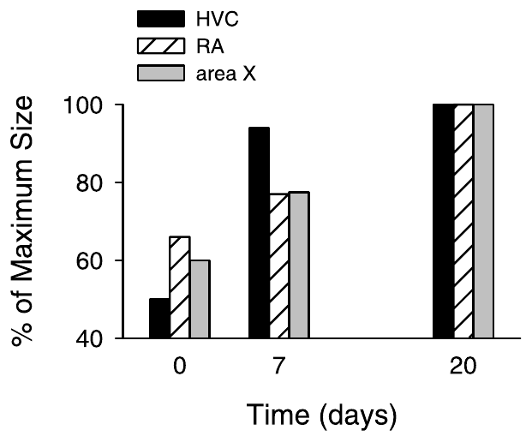
HVC reaches breeding size before its targets
Tramontin and colleagues measured the volume of HVC, RA and Area X after the combined long-day and testosterone intervention. HVC reached about 94 percent of its eventual breeding-like size within 7 days, while its targets grew more slowly. The nuclei were measured at 7 and 20 days, so each volume is tied to a specific time after treatment.
RA and Area X did not reach their larger condition until the 20-day measurement. Because the nuclei were measured across a defined time course, the result establishes an order of anatomical response within one treatment. HVC's early expansion is an earlier response than that of its targets, which is visible in the time course.
Early HVC growth is consistent with influences transmitted to downstream targets, and the order of growth is the evidence for that sequence. Manipulating HVC or its projections directly would test whether this transsynaptic mechanism operates. The timing is the basis for proposing that HVC signals to RA and Area X.
Tramontin et al. (2000), Fig. 1. Published song pathways and steroid-receptor distribution.
Tramontin et al. (2000), Fig. 3. Sequential growth of HVC, RA and Area X over 20 days.
Tramontin et al. (2000)
27
Notes:
Tramontin and colleagues measured the volume of HVC, RA and Area X after the combined long-day and testosterone intervention. HVC reached approximately 94 percent of its eventual breeding-like size within 7 days, whereas its targets grew more slowly.
RA and Area X did not reach their larger condition until the 20-day measurement. Because the nuclei were measured within a defined time course, the result establishes an order of anatomical response rather than simply a difference between two seasons.
Early HVC growth is consistent with influences transmitted to downstream targets, but temporal precedence alone is not evidence that HVC caused their growth. Direct manipulation of HVC or its projections would be needed to establish such a transsynaptic mechanism.
References:
Tramontin AD, Hartman VN, Brenowitz EA (2000). Breeding conditions induce rapid and sequential growth in adult avian song control circuits: A model of seasonal plasticity in the brain. Journal of Neuroscience 20:854–861. https://doi.org/10.1523/JNEUROSCI.20-02-00854.2000
Figure sources:
Tramontin et al. (2000), Fig. 3. Sequential growth of HVC, RA and Area X over 20 days. https://doi.org/10.1523/JNEUROSCI.20-02-00854.2000
Tramontin et al. (2000), Fig. 1. Published song pathways and steroid-receptor distribution. https://doi.org/10.1523/JNEUROSCI.20-02-00854.2000

Slide 36
HVC expands before its targets
Tramontin and colleagues measured the volume of HVC, RA and Area X after the combined long-day and testosterone intervention. HVC reached about 94 percent of its eventual breeding-like size within 7 days, while its targets grew more slowly. The treatment combined long days with testosterone, and each nucleus was measured at the same two time points.
RA and Area X reached their larger condition at the 20-day measurement, after HVC had already expanded. The order of these changes is the first evidence for a sequence of anatomical responses. HVC volume is already close to its final value at 7 days, while RA and Area X are still growing.
The nuclei were measured across one defined time course, so the order of growth is a result of the treatment. Manipulating HVC or its projections would test whether this transsynaptic sequence operates. The ordering of these responses is consistent with a sequence running from HVC to its targets.
Tramontin et al. (2000), Fig. 1. Published song pathways and steroid-receptor distribution.
Tramontin et al. (2000), Fig. 3. Sequential growth of HVC, RA and Area X over 20 days.
Tramontin et al. (2000)
27a
Notes:
HVC expands before its targets.
Explanation 1.
Tramontin and colleagues measured the volume of HVC, RA and Area X after the combined long-day and testosterone intervention
HVC reached about 94 percent of its eventual breeding-like size within 7 days, while its targets grew more slowly. The treatment combined long days with testosterone, and each nucleus was measured at the same two time points.
Explanation 2.
RA and Area X reached their larger condition at the 20-day measurement, after HVC had already expanded
The order of these changes is the first evidence for a sequence of anatomical responses. HVC volume is already close to its final value at 7 days, while RA and Area X are still growing.
Explanation 3.
The nuclei were measured across one defined time course, so the order of growth is a result of the treatment
Manipulating HVC or its projections would test whether this transsynaptic sequence operates. The ordering of these responses is consistent with a sequence running from HVC to its targets.
Source.
The figure and the measurements come from Tramontin et al. (2000).
Each statement is tied to the recordings or observations of that study.
References:
Tramontin AD, Hartman VN, Brenowitz EA (2000). Breeding conditions induce rapid and sequential growth in adult avian song control circuits: A model of seasonal plasticity in the brain. Journal of Neuroscience 20:854–861. https://doi.org/10.1523/JNEUROSCI.20-02-00854.2000

Slide 37
HVC growth includes an increase in neuron number
The sparrow study estimated neuron number, the total neuronal population within a nucleus, separately from neuron density, the population per unit of tissue volume. These quantities distinguish growth caused by more neurons from expansion around an unchanged population. Neuron number is an absolute count, while density is a count per unit volume, and the two can change independently.
Within 7 days of long-day and testosterone exposure, HVC gained about 50,000 neurons. Its density stayed relatively stable while its volume increased, so the change in total neuronal population is a substantial part of the structural response. The gain of about 50,000 neurons in 7 days is a large addition relative to the nucleus.
An increased neuron population identifies the number of cells but not the birth date of each cell. The study counted neurons in terminal tissue samples, and the cells' complete developmental histories were not followed individually. Density stayed relatively stable, so the added neurons accounted for the enlargement of the nucleus.
Tramontin et al. (2000), Fig. 1. Published song pathways and steroid-receptor distribution.
Tramontin et al. (2000), Fig. 4. Soma size, neuron density and neuron number in HVC and RA.
Tramontin et al. (2000)
28
Notes:
The sparrow study estimated neuron number, the total neuronal population within a nucleus, separately from neuron density, the population per unit tissue volume. These quantities distinguish growth caused by more neurons from expansion around an unchanged population.
Within 7 days of long-day and testosterone exposure, HVC gained approximately 50,000 neurons. Its density remained relatively stable while its volume increased, making a change in total neuronal population a substantial component of the structural response.
An increased population does not by itself identify the source or birth date of every added cell. The study counted neurons in terminal tissue samples; it did not track individual cells longitudinally or label their complete developmental histories.
References:
Tramontin AD, Hartman VN, Brenowitz EA (2000). Breeding conditions induce rapid and sequential growth in adult avian song control circuits: A model of seasonal plasticity in the brain. Journal of Neuroscience 20:854–861. https://doi.org/10.1523/JNEUROSCI.20-02-00854.2000
Figure sources:
Tramontin et al. (2000), Fig. 4. Soma size, neuron density and neuron number in HVC and RA. https://doi.org/10.1523/JNEUROSCI.20-02-00854.2000
Tramontin et al. (2000), Fig. 1. Published song pathways and steroid-receptor distribution. https://doi.org/10.1523/JNEUROSCI.20-02-00854.2000

Slide 38
Soma enlargement begins before all nuclei expand
A neuronal soma is the cell body, distinguished from axons and dendrites. Tramontin and colleagues measured cross-sectional soma area in tissue sections to test whether cellular enlargement contributed to the volume changes in HVC and RA. The soma area was measured in each nucleus separately, so the enlargement can be compared between HVC and RA.
HVC soma area increased within 7 days and remained enlarged at day 20. RA somata also enlarged by day 7, even though the major increase in RA volume came later, which distinguishes a cellular response from the timing of whole-nucleus expansion. The early RA soma enlargement occurred before the RA volume increase reached its full size.
Cross-sectional area is an anatomical measure, and enlarged somata may accompany altered physiology. Ion-channel activity and firing rate would have to be recorded from these same cells to link the size change to their function. Cell size and firing are linked in many neurons, which is why the soma measures prompt physiological follow-up.
Tramontin et al. (2000), Fig. 1. Published song pathways and steroid-receptor distribution.
Tramontin et al. (2000), Fig. 4. Soma size, neuron density and neuron number in HVC and RA.
Tramontin et al. (2000)
29
Notes:
A neuronal soma is the cell body, distinguished from axons and dendrites. Tramontin and colleagues measured cross-sectional soma area in tissue sections to test whether cellular enlargement contributed to the volume changes in HVC and RA.
HVC soma area increased within 7 days and remained enlarged at day 20. RA somata also enlarged by day 7, even though the major increase in RA volume occurred later, separating a cellular response from the timing of whole-nucleus expansion.
Cross-sectional area is an anatomical measure, not a direct measurement of membrane conductance or firing rate. Enlarged somata may accompany altered physiology, but this study did not record ion-channel activity from the cells whose sizes were measured.
References:
Tramontin AD, Hartman VN, Brenowitz EA (2000). Breeding conditions induce rapid and sequential growth in adult avian song control circuits: A model of seasonal plasticity in the brain. Journal of Neuroscience 20:854–861. https://doi.org/10.1523/JNEUROSCI.20-02-00854.2000
Figure sources:
Tramontin et al. (2000), Fig. 4. Soma size, neuron density and neuron number in HVC and RA. https://doi.org/10.1523/JNEUROSCI.20-02-00854.2000
Tramontin et al. (2000), Fig. 1. Published song pathways and steroid-receptor distribution. https://doi.org/10.1523/JNEUROSCI.20-02-00854.2000

Slide 39
RA expands without a comparable neuron increase
RA grew more slowly than HVC after breeding-like stimulation. Its neurons enlarged early, while the later increase in nucleus volume was accompanied by a reduction in neuron density rather than a clear increase in total neuron number. The RA response is a delayed version of the HVC response, with cell size changing before volume.
By day 20, the same general neuronal population occupied a larger amount of tissue. This pattern differs from HVC, where substantial population growth contributed to the enlargement within the first 7 days. The density change in RA runs opposite to the population growth in HVC, which makes the two nuclei distinct.
Lower density is consistent with more space occupied by neuronal processes or other tissue components. The study establishes different cellular signatures of seasonal growth in two connected song nuclei. Neuronal processes and glial tissue can fill space once the neuron count stops changing.
Tramontin et al. (2000), Fig. 1. Published song pathways and steroid-receptor distribution.
Tramontin et al. (2000), Fig. 4. Soma size, neuron density and neuron number in HVC and RA.
Tramontin et al. (2000)
30
Notes:
RA grew more slowly than HVC after breeding-like stimulation. Its neurons enlarged early, while the later increase in nucleus volume was accompanied by a reduction in neuron density rather than a clear increase in total neuron number.
By day 20, the same general neuronal population occupied a larger amount of tissue. This pattern differs from HVC, where substantial population growth contributed to enlargement within the first 7 days.
Lower density can be consistent with greater space occupied by neuronal processes or other tissue components, but it does not directly measure dendritic length, synapse number or glial proliferation. The study establishes different cellular signatures of seasonal growth in connected song nuclei.
References:
Tramontin AD, Hartman VN, Brenowitz EA (2000). Breeding conditions induce rapid and sequential growth in adult avian song control circuits: A model of seasonal plasticity in the brain. Journal of Neuroscience 20:854–861. https://doi.org/10.1523/JNEUROSCI.20-02-00854.2000
Figure sources:
Tramontin et al. (2000), Fig. 4. Soma size, neuron density and neuron number in HVC and RA. https://doi.org/10.1523/JNEUROSCI.20-02-00854.2000
Tramontin et al. (2000), Fig. 1. Published song pathways and steroid-receptor distribution. https://doi.org/10.1523/JNEUROSCI.20-02-00854.2000

Slide 40
RA grows through larger tissue volume
RA grew more slowly than HVC after breeding-like stimulation. Its neurons enlarged early, and the later increase in nucleus volume came with a drop in neuron density rather than a rise in total neuron number. RA's soma enlargement appears early, and its volume increase comes later in the same birds.
By day 20, the same general neuronal population occupied a larger volume of tissue. HVC differed, because substantial population growth contributed to its enlargement within the first 7 days. The density decrease in RA contrasts with the density stability seen in HVC.
A lower density fits more space taken up by neuronal processes or other tissue components. The result identifies different cellular signatures of seasonal growth in two connected song nuclei. Each nucleus therefore carries its own cellular signature of seasonal growth.
Tramontin et al. (2000), Fig. 1. Published song pathways and steroid-receptor distribution.
Tramontin et al. (2000), Fig. 4. Soma size, neuron density and neuron number in HVC and RA.
Tramontin et al. (2000)
30a
Notes:
RA grows through larger tissue volume.
Explanation 1.
RA grew more slowly than HVC after breeding-like stimulation
Its neurons enlarged early, and the later increase in nucleus volume came with a drop in neuron density rather than a rise in total neuron number. RA's soma enlargement appears early, and its volume increase comes later in the same birds.
Explanation 2.
By day 20, the same general neuronal population occupied a larger volume of tissue
HVC differed, because substantial population growth contributed to its enlargement within the first 7 days. The density decrease in RA contrasts with the density stability seen in HVC.
Explanation 3.
A lower density fits more space taken up by neuronal processes or other tissue components
The result identifies different cellular signatures of seasonal growth in two connected song nuclei. Each nucleus therefore carries its own cellular signature of seasonal growth.
Source.
The figure and the measurements come from Tramontin et al. (2000).
Each statement is tied to the recordings or observations of that study.
References:
Tramontin AD, Hartman VN, Brenowitz EA (2000). Breeding conditions induce rapid and sequential growth in adult avian song control circuits: A model of seasonal plasticity in the brain. Journal of Neuroscience 20:854–861. https://doi.org/10.1523/JNEUROSCI.20-02-00854.2000

Slide 41
Not every song nucleus follows the same growth schedule
The anterior forebrain song circuit contains Area X and LMAN, connected through the thalamic relay. Tramontin and colleagues measured these regions alongside the descending motor nuclei, which tested whether every component of the song system responded in the same way. Area X and LMAN are both part of the anterior forebrain song circuit, so their responses can be compared.
Area X enlarged more slowly than HVC and reached its expanded condition at the 20-day time point. LMAN changed little over the same interval, even though it sits in a circuit linked anatomically to the growing nuclei. Area X expanded at the 20-day time point, while LMAN stayed close to its baseline size.
Regional selectivity argues against uniform swelling of the entire song system. Receptor distribution, connectivity and cellular composition are possible contributors to the difference between regions. The different responses across the song system identify which components follow the breeding-like treatment.
Tramontin et al. (2000), Fig. 1. Published song pathways and steroid-receptor distribution.
Tramontin et al. (2000), Fig. 3. Sequential growth of HVC, RA and Area X over 20 days.
Tramontin et al. (2000)
31
Notes:
The anterior forebrain song circuit contains Area X and LMAN, connected through the thalamic relay. Tramontin and colleagues measured these regions alongside the descending motor nuclei rather than assuming that every component responded uniformly to reproductive cues.
Area X enlarged more slowly than HVC, reaching its expanded condition at the 20-day time point. LMAN changed little over the same interval, despite occupying a circuit linked anatomically to the growing nuclei.
Regional selectivity argues against uniform swelling of the entire song system. It also limits a simple explanation in which circulating testosterone produces identical structural effects wherever a song-related neuron is present; receptor distribution, connectivity and cellular composition remain possible contributors.
References:
Tramontin AD, Hartman VN, Brenowitz EA (2000). Breeding conditions induce rapid and sequential growth in adult avian song control circuits: A model of seasonal plasticity in the brain. Journal of Neuroscience 20:854–861. https://doi.org/10.1523/JNEUROSCI.20-02-00854.2000
Figure sources:
Tramontin et al. (2000), Fig. 1. Published song pathways and steroid-receptor distribution. https://doi.org/10.1523/JNEUROSCI.20-02-00854.2000
Tramontin et al. (2000), Fig. 3. Sequential growth of HVC, RA and Area X over 20 days. https://doi.org/10.1523/JNEUROSCI.20-02-00854.2000

Slide 42
Peripheral and brainstem responses have distinct timing
The syrinx is the avian vocal organ, supplied by motor neurons in nXIIts. Tramontin and colleagues measured syringeal mass and the brainstem motor nucleus to compare the peripheral vocal machinery with the forebrain changes under breeding-like stimulation. The syrinx and nXIIts are linked through the vocal motor pathway, so their volume changes can be compared.
Syringeal mass increased within 7 days of long-day and testosterone exposure. The volume of nXIIts did not enlarge clearly over the 20-day observation period, even though this nucleus can vary over longer seasonal intervals. The syringeal mass rose early, while the brainstem nucleus stayed close to its earlier size over the 20 days.
A peripheral target can respond while a connected brainstem structure still shows no detectable volume change. Whether the syrinx drives forebrain growth is a separate test, and a stable nucleus volume leaves the motor neurons' physiology open. Peripheral changes can precede changes in the connected brainstem nucleus, which sets their timing apart.
Tramontin et al. (2000), Fig. 1. Published song pathways and steroid-receptor distribution.
Tramontin et al. (2000)
32
Notes:
The syrinx is the avian vocal organ, supplied by motor neurons in nXIIts. Tramontin and colleagues measured syringeal mass and the brainstem motor nucleus to compare peripheral vocal machinery with forebrain changes under breeding-like stimulation.
Syringeal mass increased within 7 days of long-day and testosterone exposure. The volume of nXIIts did not clearly enlarge over the 20-day observation period, even though this nucleus can vary over longer seasonal intervals.
A peripheral target can therefore respond while a connected brainstem structure has not yet changed detectably in volume. The study does not establish that the syrinx drives forebrain growth, and lack of measured volume change does not mean the motor neurons were physiologically unchanged.
References:
Tramontin AD, Hartman VN, Brenowitz EA (2000). Breeding conditions induce rapid and sequential growth in adult avian song control circuits: A model of seasonal plasticity in the brain. Journal of Neuroscience 20:854–861. https://doi.org/10.1523/JNEUROSCI.20-02-00854.2000
Figure sources:
Tramontin et al. (2000), Fig. 1. Published song pathways and steroid-receptor distribution. https://doi.org/10.1523/JNEUROSCI.20-02-00854.2000

Slide 43
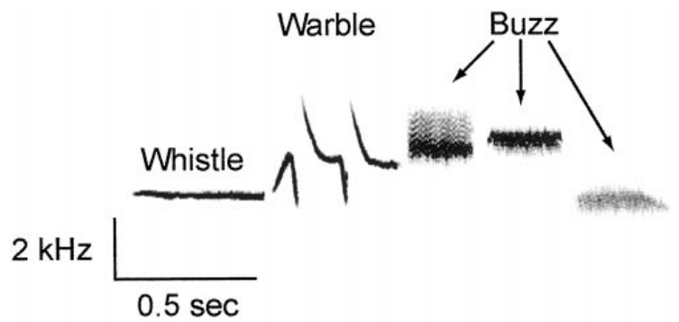
Song measurements separate duration from consistency
A spectrogram displays sound frequency over time, which allows individual song components to be measured. Tramontin and colleagues separated the white-crowned sparrow song into whistle, warble and buzz portions, using the published 2-kilohertz and 0.5-second calibration bars. The spectrogram measures frequency and time, so each component of the song can be assigned a duration.
Mean whole-song duration was 1.80 seconds after 7 days of breeding-like stimulation and 1.84 seconds after 20 days. Whistle duration was similarly stable, at about 0.51 and 0.52 seconds at the two time points. The duration measures were nearly identical at the two time points, which shows stability of the song's average timing.
Stable average duration coexists with changes in how consistently the song is produced. Variation across repeated songs addresses consistency, while average durations describe the central timing of the vocal pattern. Consistency is measured from the variation across repeated songs, which is a separate property from the average duration.
Tramontin et al. (2000), Fig. 2. White-crowned sparrow song; 2 kHz and 0.5 s bars.
Tramontin et al. (2000)
33
Notes:
A spectrogram displays sound frequency over time, permitting individual song components to be measured. Tramontin and colleagues separated the white-crowned sparrow song into whistle, warble and buzz portions, using the published 2-kilohertz and 0.5-second calibration bars.
Mean whole-song duration was 1.80 seconds after 7 days of breeding-like stimulation and 1.84 seconds after 20 days. Whistle duration was similarly stable, approximately 0.51 and 0.52 seconds at the two time points.
Stable average duration does not mean identical renditions. Measurements of variation across repeated songs address consistency, while average durations describe the central timing of the vocal pattern. The study did not record comparable songs from the short-day birds because they did not sing.
References:
Tramontin AD, Hartman VN, Brenowitz EA (2000). Breeding conditions induce rapid and sequential growth in adult avian song control circuits: A model of seasonal plasticity in the brain. Journal of Neuroscience 20:854–861. https://doi.org/10.1523/JNEUROSCI.20-02-00854.2000
Figure sources:
Tramontin et al. (2000), Fig. 2. White-crowned sparrow song; 2 kHz and 0.5 s bars. https://doi.org/10.1523/JNEUROSCI.20-02-00854.2000

Slide 44
Song duration and consistency are separate measures
A spectrogram displays sound frequency over time, so individual song components can be measured. Tramontin and colleagues divided the white-crowned sparrow song into whistle, warble and buzz portions, using the published 2 kHz and 0.5 s calibration bars. The whistle, warble and buzz portions were measured from the same published song spectrograms.
Mean song duration was 1.80 seconds after 7 days of breeding-like stimulation and 1.84 seconds after 20 days. Whistle duration stayed close to 0.51 and 0.52 seconds across the two time points. The duration of each portion was stable across the two time points.
Average duration and repeat-to-repeat consistency describe different properties of the vocal pattern. The average gives the central timing, while variation across repeated songs gives the consistency. Consistency across repeated songs is measured separately from the average timing.
Tramontin et al. (2000), Fig. 2. White-crowned sparrow song; 2 kHz and 0.5 s bars.
Tramontin et al. (2000)
33a
Notes:
Song duration and consistency are separate measures.
Explanation 1.
A spectrogram displays sound frequency over time, so individual song components can be measured
Tramontin and colleagues divided the white-crowned sparrow song into whistle, warble and buzz portions, using the published 2 kHz and 0.5 s calibration bars. The whistle, warble and buzz portions were measured from the same published song spectrograms.
Explanation 2.
Mean song duration was 1.80 seconds after 7 days of breeding-like stimulation and 1.84 seconds after 20 days
Whistle duration stayed close to 0.51 and 0.52 seconds across the two time points. The duration of each portion was stable across the two time points.
Explanation 3.
Average duration and repeat-to-repeat consistency describe different properties of the vocal pattern
The average gives the central timing, while variation across repeated songs gives the consistency. Consistency across repeated songs is measured separately from the average timing.
Source.
The figure and the measurements come from Tramontin et al. (2000).
Each statement is tied to the recordings or observations of that study.
References:
Tramontin AD, Hartman VN, Brenowitz EA (2000). Breeding conditions induce rapid and sequential growth in adult avian song control circuits: A model of seasonal plasticity in the brain. Journal of Neuroscience 20:854–861. https://doi.org/10.1523/JNEUROSCI.20-02-00854.2000

Slide 45
Song becomes more stereotyped as circuits mature
Stereotypy means consistency across repeated performances. The sparrows' temporal and spectral song features were more consistent after 20 days of breeding-like stimulation than after 7 days, even though mean song duration changed little. The temporal and spectral features are measured across repeated songs, so the consistency of each feature can be scored.
Song rates were similar at the two time points, at about three songs per minute during recording. Increased consistency therefore reflects the song itself rather than more frequent singing, and it accompanied the slower growth of RA and Area X. Song rate was about three songs per minute at both time points, which keeps the rate constant across both time points.
The study linked behavioral and anatomical time courses, and circuit maturation and song stabilization changed together. The cellular change responsible for the improved consistency remains to be identified by these measurements. The stabilization of song features accompanies the slower growth of RA and Area X in the same birds.
Tramontin et al. (2000), Fig. 2. White-crowned sparrow song; 2 kHz and 0.5 s bars.
Tramontin et al. (2000), Fig. 1. Published song pathways and steroid-receptor distribution.
Tramontin et al. (2000)
34
Notes:
Stereotypy means consistency across repeated performances. The sparrows’ temporal and spectral song features were more consistent after 20 days of breeding-like stimulation than after 7 days, even though mean song duration changed little.
Song rates were similar at the two time points, approximately three songs per minute during recording. Increased consistency therefore cannot be equated with simply singing more frequently, and it accompanied the slower growth of RA and Area X.
The study linked behavioral and anatomical time courses, but did not independently manipulate nucleus size while holding hormonal state constant. Circuit maturation and song stabilization covaried; the exact cellular change responsible for the improved consistency remains unresolved by these measurements.
References:
Tramontin AD, Hartman VN, Brenowitz EA (2000). Breeding conditions induce rapid and sequential growth in adult avian song control circuits: A model of seasonal plasticity in the brain. Journal of Neuroscience 20:854–861. https://doi.org/10.1523/JNEUROSCI.20-02-00854.2000
Figure sources:
Tramontin et al. (2000), Fig. 2. White-crowned sparrow song; 2 kHz and 0.5 s bars. https://doi.org/10.1523/JNEUROSCI.20-02-00854.2000
Tramontin et al. (2000), Fig. 1. Published song pathways and steroid-receptor distribution. https://doi.org/10.1523/JNEUROSCI.20-02-00854.2000

Slide 46
Sequential growth supports a trophic hypothesis
A trophic influence is an effect that supports growth or maintenance of another cell or tissue. HVC grew before RA and Area X, which creates the possibility that signals from HVC contribute to the later enlargement of its connected targets. HVC is the earliest responder in the sequence, which places it at the start of the pathway that the study measured.
The long-day and testosterone experiment established the temporal sequence and distinct cellular responses: rapid HVC population growth, early soma enlargement, and later expansion of downstream nuclei. These findings constrain explanations of seasonal plasticity more precisely than volume comparisons alone. Soma enlargement and population growth both occur early in HVC, while the downstream nuclei enlarge later.
Blocking a growth factor or an HVC projection would test the proposed trophic relationship directly. Direct steroid sensitivity, activity changes and other local mechanisms can also contribute, so the sequential growth supports the hypothesis. The steroid sensitivity of the targets and their activity changes are alternative contributors to the same sequence.
Tramontin et al. (2000), Fig. 1. Published song pathways and steroid-receptor distribution.
Tramontin et al. (2000), Fig. 3. Sequential growth of HVC, RA and Area X over 20 days.
Tramontin et al. (2000)
35
Notes:
A trophic influence is an effect that supports growth or maintenance of another cell or tissue. HVC grew before RA and Area X, creating the possibility that signals from HVC contribute to the subsequent enlargement of its connected targets.
The long-day and testosterone experiment established temporal sequence and distinct cellular responses: rapid HVC population growth, early soma enlargement, and later expansion of downstream nuclei. These findings constrain explanations of seasonal plasticity more precisely than volume comparisons alone.
The proposed trophic relationship was not directly tested by blocking a growth factor or an HVC projection. Direct steroid sensitivity, activity changes and other local mechanisms can also contribute, so sequential growth should remain evidence supporting a hypothesis rather than proof of one pathway.
References:
Tramontin AD, Hartman VN, Brenowitz EA (2000). Breeding conditions induce rapid and sequential growth in adult avian song control circuits: A model of seasonal plasticity in the brain. Journal of Neuroscience 20:854–861. https://doi.org/10.1523/JNEUROSCI.20-02-00854.2000
Figure sources:
Tramontin et al. (2000), Fig. 3. Sequential growth of HVC, RA and Area X over 20 days. https://doi.org/10.1523/JNEUROSCI.20-02-00854.2000
Tramontin et al. (2000), Fig. 1. Published song pathways and steroid-receptor distribution. https://doi.org/10.1523/JNEUROSCI.20-02-00854.2000

Slide 47
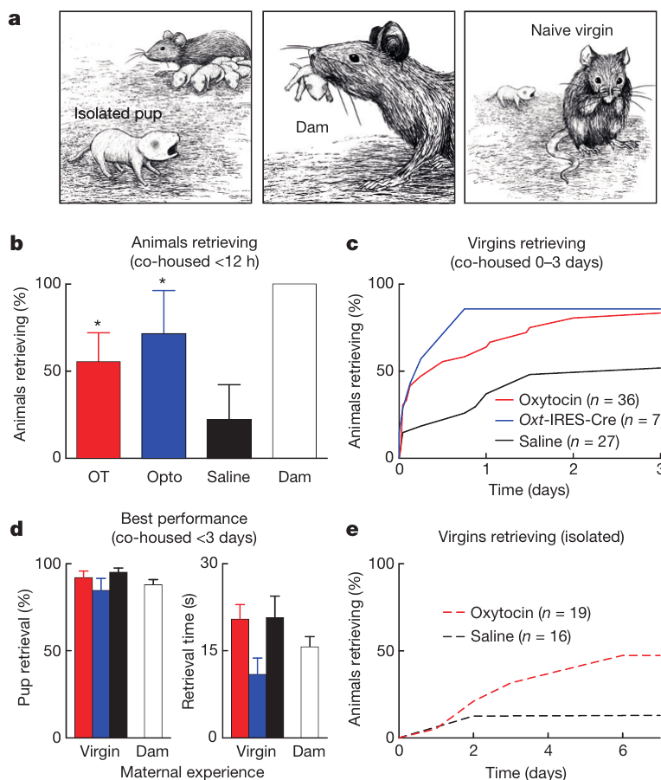
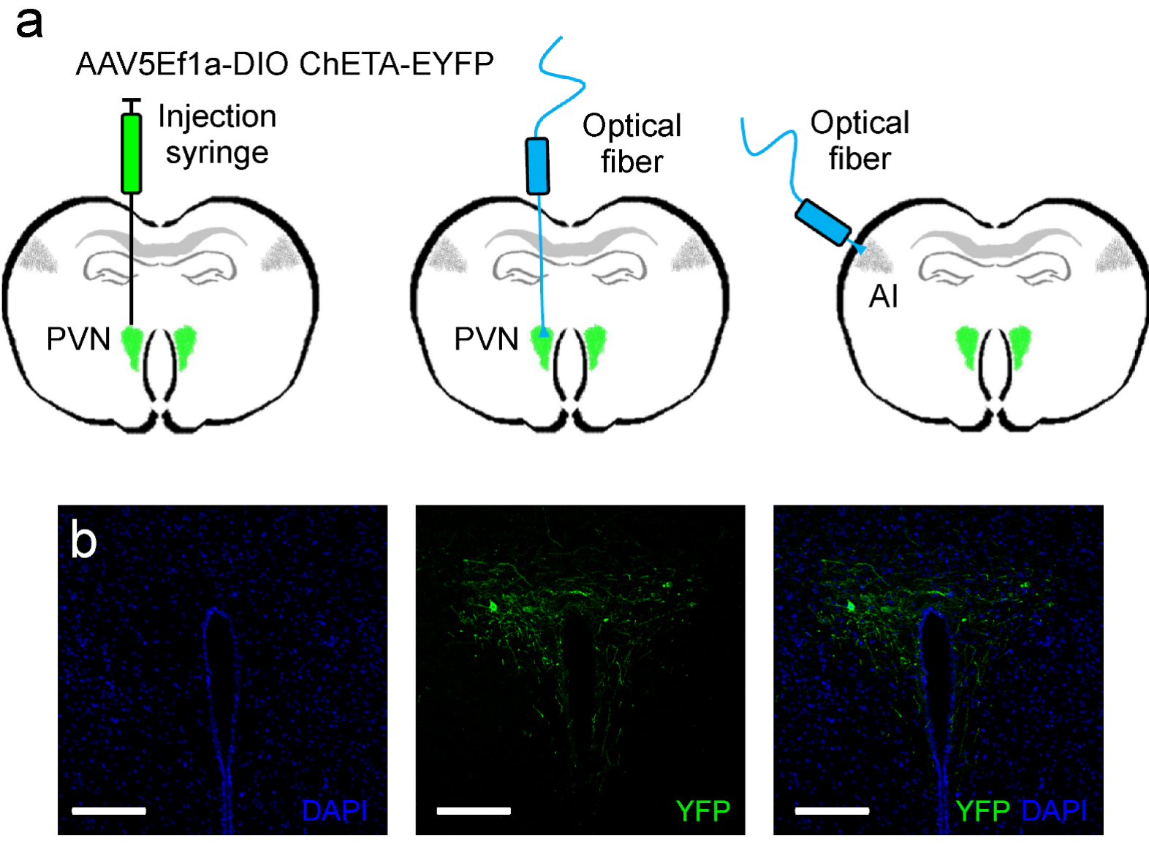
Oxytocin accelerates experience-dependent pup retrieval
Oxytocin is a neuropeptide synthesized by hypothalamic neurons, including those in the paraventricular nucleus, or PVN. Marlin and colleagues tested its central behavioral effects in female mice, a mammalian comparison that clarifies how the hormone acts in a related setting. Oxytocin's central effects are tested here in females, which allows the behavioral measures to be taken on each animal.
Initially inexperienced virgin females were housed with a mother and her pups. Systemic oxytocin, or optical stimulation of genetically targeted PVN oxytocin neurons, accelerated retrieval of isolated pups, with many females beginning within 12 hours of co-housing. The retrieval measure is the success and speed of bringing the pup back, which the experiment scored in each female.
Saline-treated females generally needed longer experience to begin retrieving. The manipulation changed how quickly a social setting produced the response, which makes oxytocin a regulator of when experience translates into behavior. The PVN is the source of the oxytocin neurons that the optical stimulation targeted.
Marlin et al. (2015), Fig. Extended Data 1(a,b). Oxytocin-neuron targeting in mouse PVN; bars 100 µm.
Marlin et al. (2015), Fig. 1(a–e). Mouse pup retrieval with oxytocin and maternal experience.
Marlin et al. (2015)
36
Notes:
Oxytocin is a neuropeptide synthesized by hypothalamic neurons, including those in the paraventricular nucleus, or PVN. Marlin and colleagues tested its central behavioral effects in female mice, a mammalian comparison rather than a mechanism established for ring doves.
Initially inexperienced virgin females were housed with a mother and pups. Systemic oxytocin or optical stimulation of genetically targeted PVN oxytocin neurons accelerated retrieval of isolated pups, with many females beginning within 12 hours of co-housing.
Saline-treated females generally required longer experience. The manipulation changed the speed of acquiring a response in a social setting; it did not establish that oxytocin makes every inexperienced female perform maternal behavior independently of experience or pup-derived signals.
References:
Marlin BJ, Mitre M, D’amour JA, Chao MV, Froemke RC (2015). Oxytocin enables maternal behaviour by balancing cortical inhibition. Nature 520:499–504. https://doi.org/10.1038/nature14402
Figure sources:
Marlin et al. (2015), Fig. 1(a–e). Mouse pup retrieval with oxytocin and maternal experience. https://doi.org/10.1038/nature14402
Marlin et al. (2015), Fig. Extended Data 1(a,b). Oxytocin-neuron targeting in mouse PVN; bars 100 µm. https://doi.org/10.1038/nature14402

Slide 48
Oxytocin accelerates pup retrieval in females
Marlin and colleagues tested oxytocin's central behavioral effects in female mice, a mammalian system that clarifies how the hormone acts. Oxytocin is a neuropeptide made by hypothalamic neurons, including those in the paraventricular nucleus, or PVN. The retrieval measure captures how quickly the female returns the pup, which is a learned response.
Initially inexperienced virgin females were housed with a mother and her pups. Systemic oxytocin, or optical stimulation of PVN oxytocin neurons, sped retrieval of isolated pups, and many females began within 12 hours of co-housing. The oxytocin manipulation changed the speed at which social experience produced retrieval.
Saline-treated females needed longer experience before retrieving. Oxytocin therefore changed how quickly a social setting produced the response, which makes it a regulator of when experience becomes behavior. The PVN supplies the oxytocin-producing neurons whose optical stimulation produced the same speeding.
Marlin et al. (2015), Fig. Extended Data 1(a,b). Oxytocin-neuron targeting in mouse PVN; bars 100 µm.
Marlin et al. (2015), Fig. 1(a–e). Mouse pup retrieval with oxytocin and maternal experience.
Marlin et al. (2015)
36a
Notes:
Oxytocin accelerates pup retrieval in females.
Explanation 1.
Marlin and colleagues tested oxytocin's central behavioral effects in female mice, a mammalian system that clarifies how the hormone acts
Oxytocin is a neuropeptide made by hypothalamic neurons, including those in the paraventricular nucleus, or PVN. The retrieval measure captures how quickly the female returns the pup, which is a learned response.
Explanation 2.
Initially inexperienced virgin females were housed with a mother and her pups
Systemic oxytocin, or optical stimulation of PVN oxytocin neurons, sped retrieval of isolated pups, and many females began within 12 hours of co-housing. The oxytocin manipulation changed the speed at which social experience produced retrieval.
Explanation 3.
Saline-treated females needed longer experience before retrieving
Oxytocin therefore changed how quickly a social setting produced the response, which makes it a regulator of when experience becomes behavior. The PVN supplies the oxytocin-producing neurons whose optical stimulation produced the same speeding.
Source.
The figure and the measurements come from Marlin et al. (2015).
Each statement is tied to the recordings or observations of that study.
References:
Marlin BJ, Mitre M, D’amour JA, Chao MV, Froemke RC (2015). Oxytocin enables maternal behaviour by balancing cortical inhibition. Nature 520:499–504. https://doi.org/10.1038/nature14402

Slide 49
Maternal experience can substitute for pregnancy history
Marlin and colleagues compared mothers, inexperienced virgin females, and virgin females that acquired pup-retrieval behavior through experience. Retrieval is carrying an isolated pup back toward the nest, and the study measured both the success of each response and the time needed to perform it. The three groups differed in experience and hormone exposure, so their retrieval can be compared across these factors.
Experienced virgins retrieved with rates and speeds comparable to mothers. Oxytocin accelerated acquisition, while isolated virgins given oxytocin acquired retrieval more slowly than co-housed virgins that received both hormonal modulation and social experience. Experienced virgins reached mothers' rates and speeds, which places experience close to pregnancy in its effect.
Pregnancy and parturition were therefore not necessary for successful performance in this setting. Maternal endocrine history is one route to the behavior, and experience provides an alternative route to the same measured outcome in female mice. Maternal behavior can therefore be reached through either pregnancy or the experience of retrieving pups.
Marlin et al. (2015), Fig. 1(a–e). Mouse pup retrieval with oxytocin and maternal experience.
Marlin et al. (2015)
37
Notes:
Marlin and colleagues compared mothers, inexperienced virgin females, and virgin females that acquired pup-retrieval behavior through experience. Retrieval is carrying an isolated pup back toward the nest, measured separately as successful responses and the time needed to perform them.
Experienced virgins retrieved with rates and speeds comparable to mothers. Oxytocin accelerated acquisition, while isolated virgins given oxytocin acquired retrieval more slowly than co-housed virgins receiving both hormonal modulation and social experience.
Pregnancy and parturition were therefore not necessary for successful performance in this experimental setting. The finding does not imply that maternal endocrine history is irrelevant; it establishes an alternative experiential route to the measured behavior in female mice.
References:
Marlin BJ, Mitre M, D’amour JA, Chao MV, Froemke RC (2015). Oxytocin enables maternal behaviour by balancing cortical inhibition. Nature 520:499–504. https://doi.org/10.1038/nature14402
Figure sources:
Marlin et al. (2015), Fig. 1(a–e). Mouse pup retrieval with oxytocin and maternal experience. https://doi.org/10.1038/nature14402

Slide 50
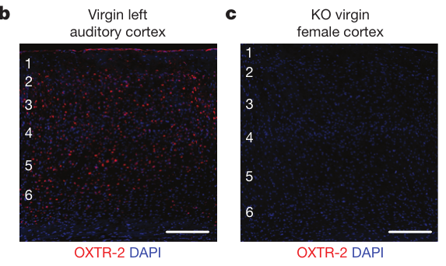
Knockout controls verify cortical receptor labeling
An oxytocin receptor is a membrane protein coupled to intracellular signaling through G proteins, rather than a pore that carries synaptic current. Marlin and colleagues developed an antibody and tested its labeling against receptor-deficient mice, whose auditory cortex lacked the staining seen in normal animals. The antibody was tested in receptor-deficient animals, which provides a negative control for the staining.
They also compared the staining with a genetic reporter linked to oxytocin-receptor expression. Agreement between independent labeling methods strengthened the interpretation that the marked cells express the receptor rather than an unrelated protein that the antibody recognizes. The genetic reporter and the antibody label the same population, which supports the receptor identity of the labeled cells.
The auditory cortex is cortical tissue involved in sound processing. Receptor staining locates candidate sites of hormonal modulation, and the strength of receptor activation and its behavioral role are measured with physiological and intervention experiments. Receptor labeling in the cortex identifies sites of hormone action in the sound-processing region.
Marlin et al. (2015), Fig. 2(b,c). Receptor staining and knockout control; bars 150 µm.
Marlin et al. (2015)
38
Notes:
An oxytocin receptor is a membrane protein coupled to intracellular signaling through G proteins, rather than a pore directly carrying synaptic current. Marlin and colleagues developed an antibody and tested its labeling against receptor-deficient mice, whose auditory cortex lacked the staining detected in normal animals.
They also compared staining with a genetic reporter linked to oxytocin-receptor expression. Agreement between independent labeling methods strengthened the interpretation that the marked cells express the receptor rather than an unrelated protein recognized by the antibody.
The auditory cortex is cortical tissue involved in sound processing. Receptor staining locates candidate sites of hormonal modulation, but does not measure receptor activation, downstream signaling strength or behavioral necessity. Those questions require physiological and intervention experiments in addition to anatomy.
References:
Marlin BJ, Mitre M, D’amour JA, Chao MV, Froemke RC (2015). Oxytocin enables maternal behaviour by balancing cortical inhibition. Nature 520:499–504. https://doi.org/10.1038/nature14402
Figure sources:
Marlin et al. (2015), Fig. 2(b,c). Receptor staining and knockout control; bars 150 µm. https://doi.org/10.1038/nature14402

Slide 51
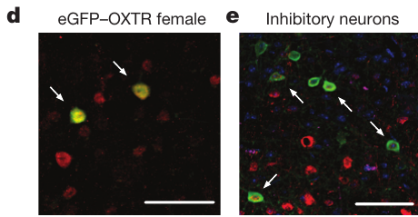
Cortical inhibition contains oxytocin-sensitive cells
Interneurons are local neurons that influence neighboring cells within a circuit. Marlin and colleagues identified oxytocin receptors on inhibitory cortical interneurons marked by parvalbumin or somatostatin, proteins used to distinguish major inhibitory cell populations. Parvalbumin and somatostatin mark distinct inhibitory populations, so their overlap with oxytocin receptors is informative.
About 30–40 percent of the labeled parvalbumin-positive and somatostatin-positive populations expressed oxytocin receptors. Hormone sensitivity therefore included cells positioned to regulate local inhibition, not only excitatory output neurons. The labeled cells are inhibitory interneurons in the cortex, which places hormone sensitivity in the local inhibitory network.
This colocalization supports a candidate route from oxytocin to inhibitory control. Synaptic recordings identify how inhibition changed during hormone exposure and learning-related stimulation, which the staining alone leaves open. The receptor-positive interneurons are therefore candidate regulators of cortical output.
Marlin et al. (2015), Fig. 2(d,e). Receptor-positive cortical cells and interneurons; bars 50 µm.
Marlin et al. (2015)
39
Notes:
Interneurons are local neurons that influence neighboring cells within a circuit. Marlin and colleagues identified oxytocin receptors on inhibitory cortical interneurons marked by parvalbumin or somatostatin, proteins used to distinguish important inhibitory cell populations.
Approximately 30–40 percent of the labeled parvalbumin-positive and somatostatin-positive populations expressed oxytocin receptors. Thus, hormone sensitivity included cells positioned to regulate local inhibition rather than being restricted to excitatory output neurons.
This colocalization supports a candidate route from oxytocin to inhibitory control, but the staining does not establish identical physiological effects in every receptor-positive cell. Subsequent synaptic recordings were required to determine how inhibition changed during hormone exposure and learning-related stimulation.
References:
Marlin BJ, Mitre M, D’amour JA, Chao MV, Froemke RC (2015). Oxytocin enables maternal behaviour by balancing cortical inhibition. Nature 520:499–504. https://doi.org/10.1038/nature14402
Figure sources:
Marlin et al. (2015), Fig. 2(d,e). Receptor-positive cortical cells and interneurons; bars 50 µm. https://doi.org/10.1038/nature14402

Slide 52
Oxytocin receptors sit on inhibitory interneurons
Interneurons are local neurons that influence neighboring cells within a circuit. Marlin and colleagues identified oxytocin receptors on inhibitory cortical interneurons marked by parvalbumin or somatostatin. The labeled interneurons were identified by their parvalbumin or somatostatin content.
About 30–40 percent of the labeled parvalbumin-positive and somatostatin-positive populations expressed oxytocin receptors. Hormone sensitivity therefore reached cells positioned to regulate local inhibition, not only excitatory output neurons. The receptor-positive fraction of each population was measured in the same cortex.
Oxytocin's effect on inhibition is a candidate route to control of local circuits. Synaptic recordings show how inhibition changed during hormone exposure and learning-related stimulation. The overlap places hormone sensitivity in the inhibitory interneurons of the auditory cortex.
Marlin et al. (2015), Fig. 2(d,e). Receptor-positive cortical cells and interneurons; bars 50 µm.
Marlin et al. (2015)
39a
Notes:
Oxytocin receptors sit on inhibitory interneurons.
Explanation 1.
Interneurons are local neurons that influence neighboring cells within a circuit
Marlin and colleagues identified oxytocin receptors on inhibitory cortical interneurons marked by parvalbumin or somatostatin. The labeled interneurons were identified by their parvalbumin or somatostatin content.
Explanation 2.
About 30–40 percent of the labeled parvalbumin-positive and somatostatin-positive populations expressed oxytocin receptors
Hormone sensitivity therefore reached cells positioned to regulate local inhibition, not only excitatory output neurons. The receptor-positive fraction of each population was measured in the same cortex.
Explanation 3.
Oxytocin's effect on inhibition is a candidate route to control of local circuits
Synaptic recordings show how inhibition changed during hormone exposure and learning-related stimulation. The overlap places hormone sensitivity in the inhibitory interneurons of the auditory cortex.
Source.
The figure and the measurements come from Marlin et al. (2015).
Each statement is tied to the recordings or observations of that study.
References:
Marlin BJ, Mitre M, D’amour JA, Chao MV, Froemke RC (2015). Oxytocin enables maternal behaviour by balancing cortical inhibition. Nature 520:499–504. https://doi.org/10.1038/nature14402

Slide 53
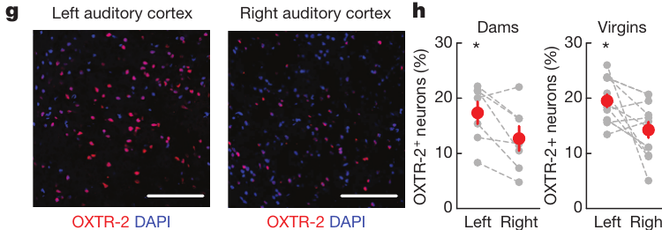
Receptor expression favors the left auditory cortex
Marlin and colleagues compared the left and right auditory cortex within female mice. Oxytocin-receptor labeling was more abundant on the left in both mothers and inexperienced virgins, which shows that the asymmetry is present before any retrieval experience. Both hemispheres were examined in the same mice, so the difference is a within-animal comparison.
In virgin females, about 19.5 percent of cells were receptor-positive on the left, against 14.3 percent on the right. Hypothalamic axonal projections did not show an equally clear asymmetry, which suggests that receptor distribution contributes to local sensitivity. The left-right difference in cell fraction was measured in both mothers and virgins, which shows the asymmetry is independent of retrieval.
An anatomical asymmetry identifies a candidate difference between hemispheres. Separately manipulating activity or oxytocin signaling in the left and right sound-processing regions tests whether that difference has a behavioral role. The receptor distribution is the candidate basis for the hemispheric difference in hormone sensitivity.
Marlin et al. (2015), Fig. 2(g,h). Left–right cortical receptor expression; bars 100 µm.
Marlin et al. (2015)
40
Notes:
Marlin and colleagues compared the left and right auditory cortex within female mice. Oxytocin-receptor labeling was more abundant on the left in both mothers and inexperienced virgins, indicating that the asymmetry was not limited to animals already performing retrieval.
In virgin females, approximately 19.5 percent of cells were receptor-positive on the left, compared with 14.3 percent on the right. Hypothalamic axonal projections did not have an equally obvious asymmetry, suggesting that receptor distribution contributes to local sensitivity.
An anatomical asymmetry does not by itself establish behavioral specialization. It identifies a candidate difference between hemispheres that can be tested by separately manipulating activity or oxytocin signaling in the left and right sound-processing regions.
References:
Marlin BJ, Mitre M, D’amour JA, Chao MV, Froemke RC (2015). Oxytocin enables maternal behaviour by balancing cortical inhibition. Nature 520:499–504. https://doi.org/10.1038/nature14402
Figure sources:
Marlin et al. (2015), Fig. 2(g,h). Left–right cortical receptor expression; bars 100 µm. https://doi.org/10.1038/nature14402

Slide 54
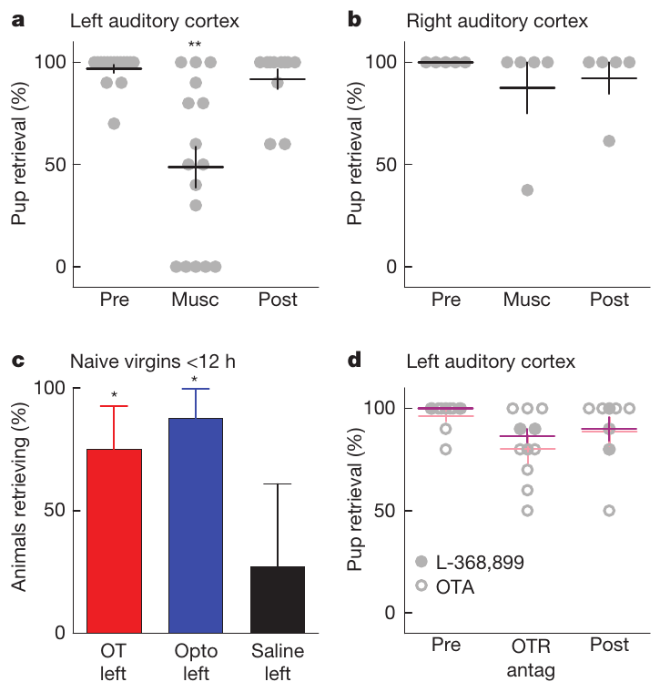
Left auditory-cortex activity contributes to retrieval
Marlin and colleagues infused muscimol, an agonist of inhibitory GABA_A receptors, into one auditory cortex at a time. GABA is an inhibitory neurotransmitter, and GABA_A receptors are ion channels whose conductance constrains excitation. The drug temporarily reduced local activity before retrieval testing. The infusions were given into one hemisphere at a time, so each cortex is tested in isolation.
Inactivation of the left cortex impaired retrieval in experienced females, while the corresponding right-side infusion produced no comparable impairment. Measurements before and after treatment separated the transient effect of the drug from a lasting change in the ability to perform the task. The right-side infusion left retrieval intact, so the effect is specific to the left cortex in this setting.
The result identifies a contribution from left cortical activity under these conditions. Hearing a relevant call and carrying a pup also depend on sensory, motivational and motor components outside the infused region. Hearing a call and carrying a pup involve the sensory and motor systems outside the left cortex.
Marlin et al. (2015), Fig. 2(g,h). Left–right cortical receptor expression; bars 100 µm.
Marlin et al. (2015), Fig. 3(a–d). Cortical inactivation, oxytocin and receptor antagonists.
Marlin et al. (2015)
41
Notes:
Marlin and colleagues infused muscimol, an agonist of inhibitory GABAA receptors, into one auditory cortex at a time. GABA is an inhibitory neurotransmitter; GABAA receptors are ion channels whose conductance constrains excitation. The intervention temporarily reduced local activity before retrieval testing.
Inactivation of the left cortex impaired retrieval in experienced females, whereas the corresponding right-side manipulation did not produce the same impairment. Before-treatment and after-treatment measurements helped distinguish the transient intervention effect from a permanent inability to perform the task.
The result establishes a contribution from left cortical activity under these conditions, not that this region alone generates the entire motor behavior. Hearing a relevant call and carrying a pup depend on additional sensory, motivational and motor components outside the infused region.
References:
Marlin BJ, Mitre M, D’amour JA, Chao MV, Froemke RC (2015). Oxytocin enables maternal behaviour by balancing cortical inhibition. Nature 520:499–504. https://doi.org/10.1038/nature14402
Figure sources:
Marlin et al. (2015), Fig. 3(a–d). Cortical inactivation, oxytocin and receptor antagonists. https://doi.org/10.1038/nature14402
Marlin et al. (2015), Fig. 2(g,h). Left–right cortical receptor expression; bars 100 µm. https://doi.org/10.1038/nature14402

Slide 55
Oxytocin facilitates acquisition more than performance
Local oxytocin delivery to the left auditory cortex accelerated retrieval in inexperienced female mice. Optical stimulation of oxytocin axons in the same region produced a similar acceleration, which links a localized neuromodulatory input to acquisition in the presence of pups and social experience.
Oxytocin-receptor antagonists infused into the left auditory cortex did not clearly impair retrieval after the behavior was established. An antagonist blocks receptor activation, so it tests ongoing signaling separately from the effects of earlier exposure. The antagonist was infused after the behavior was established, so the test examined ongoing receptor signaling.
Acquisition and performance have different experimental dependencies. The result fits lasting circuit changes after oxytocin-assisted experience, and it shows that the established behavior persists after receptor signaling is blocked. Acquisition depends on the oxytocin input, while the established performance persists without receptor signaling.
Marlin et al. (2015), Fig. 2(b,c). Receptor staining and knockout control; bars 150 µm.
Marlin et al. (2015), Fig. 3(a–d). Cortical inactivation, oxytocin and receptor antagonists.
Marlin et al. (2015)
42
Notes:
Local oxytocin delivery to the left auditory cortex accelerated retrieval in inexperienced female mice. Optical stimulation of oxytocin axons there produced a similar acceleration, connecting a localized neuromodulatory input to acquisition in the presence of pups and social experience.
In contrast, oxytocin-receptor antagonists infused into the left auditory cortex did not clearly impair retrieval after the behavior was established. An antagonist blocks receptor activation, allowing ongoing signaling to be tested separately from the effects of earlier exposure.
Acquisition and performance therefore have different experimental dependencies. The result is consistent with lasting circuit changes after oxytocin-assisted experience, but antagonist failure does not prove that oxytocin is unnecessary at every other site or during every maternal behavior.
References:
Marlin BJ, Mitre M, D’amour JA, Chao MV, Froemke RC (2015). Oxytocin enables maternal behaviour by balancing cortical inhibition. Nature 520:499–504. https://doi.org/10.1038/nature14402
Figure sources:
Marlin et al. (2015), Fig. 3(a–d). Cortical inactivation, oxytocin and receptor antagonists. https://doi.org/10.1038/nature14402
Marlin et al. (2015), Fig. 2(b,c). Receptor staining and knockout control; bars 150 µm. https://doi.org/10.1038/nature14402

Slide 56
Oxytocin acts most strongly on acquisition
Local oxytocin delivery to the left auditory cortex accelerated retrieval in inexperienced females. Optical stimulation of oxytocin axons in the same region produced a similar acceleration, which links a localized input to acquisition. The left-cortex oxytocin delivery and the optical axon stimulation used the same target region.
Oxytocin-receptor antagonists infused into the left cortex left retrieval largely intact once the behavior was established. An antagonist blocks receptor activation, so it tests ongoing signaling apart from earlier exposure. Antagonist infusion after learning showed that the performance of the behavior persists.
Acquisition and performance therefore have different experimental dependencies. The result fits lasting circuit changes after oxytocin-assisted experience, which the established behavior shows when receptor signaling is blocked. Acquisition and performance therefore have distinct dependencies on oxytocin signaling.
Marlin et al. (2015), Fig. 2(b,c). Receptor staining and knockout control; bars 150 µm.
Marlin et al. (2015), Fig. 3(a–d). Cortical inactivation, oxytocin and receptor antagonists.
Marlin et al. (2015)
42a
Notes:
Oxytocin acts most strongly on acquisition.
Explanation 1.
Local oxytocin delivery to the left auditory cortex accelerated retrieval in inexperienced females
Optical stimulation of oxytocin axons in the same region produced a similar acceleration, which links a localized input to acquisition. The left-cortex oxytocin delivery and the optical axon stimulation used the same target region.
Explanation 2.
Oxytocin-receptor antagonists infused into the left cortex left retrieval largely intact once the behavior was established
An antagonist blocks receptor activation, so it tests ongoing signaling apart from earlier exposure. Antagonist infusion after learning showed that the performance of the behavior persists.
Explanation 3.
Acquisition and performance therefore have different experimental dependencies
The result fits lasting circuit changes after oxytocin-assisted experience, which the established behavior shows when receptor signaling is blocked. Acquisition and performance therefore have distinct dependencies on oxytocin signaling.
Source.
The figure and the measurements come from Marlin et al. (2015).
Each statement is tied to the recordings or observations of that study.
References:
Marlin BJ, Mitre M, D’amour JA, Chao MV, Froemke RC (2015). Oxytocin enables maternal behaviour by balancing cortical inhibition. Nature 520:499–504. https://doi.org/10.1038/nature14402

Slide 57
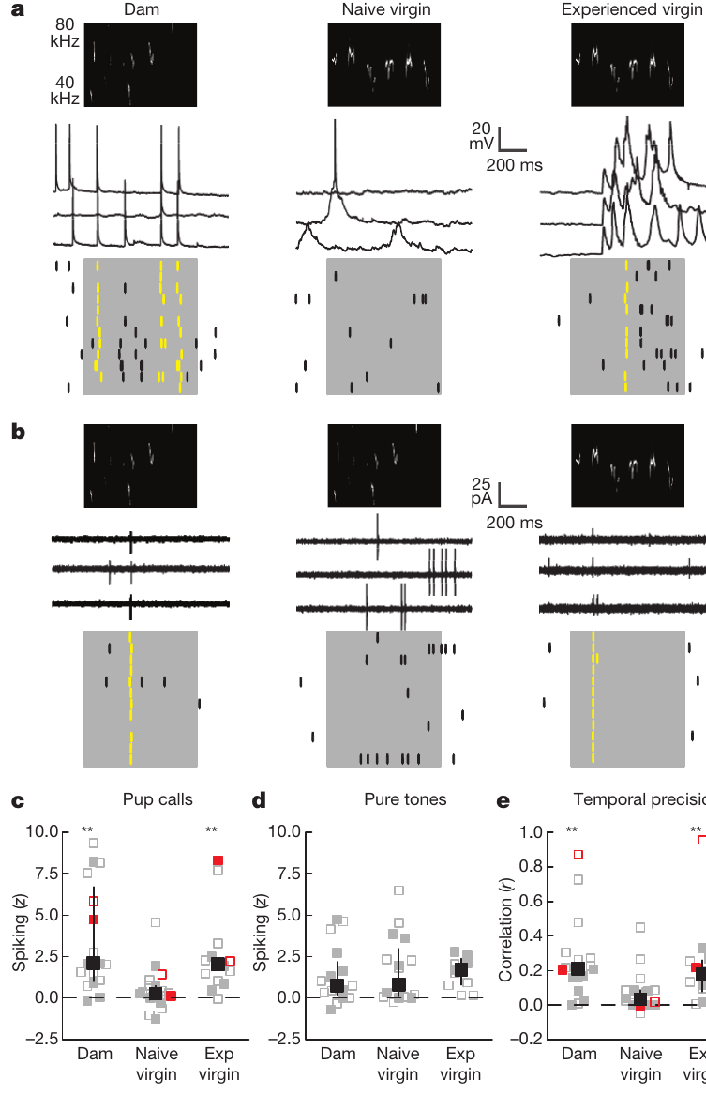
Experience improves call-evoked spike reliability
An action potential is a brief electrical event that neurons use to transmit output. Marlin and colleagues recorded single-cell responses to pup calls in mothers, inexperienced virgins and experienced virgins, using electrodes in the auditory cortex of anesthetized animals. Single-cell recordings were made in the same cortical region that the infusions targeted, which links the two experiments.
Calls evoked stronger and more precisely timed spiking in the left cortex of experienced females. Responses to pure tones were broadly comparable across groups, which shows that the change is specific to behaviorally relevant vocal signals. The pure-tone control shows that the spiking change is specific to pup calls rather than a general increase in responsiveness.
Experience therefore modifies how cortical neurons respond to pup calls. These recordings characterize responses to controlled playback under anesthesia, and the awake retrieval episode and the downstream motor pathway are measured by other means. The change in spike reliability shows an experience-dependent response to the calls that drive retrieval.
Marlin et al. (2015), Fig. 2(b,c). Receptor staining and knockout control; bars 150 µm.
Marlin et al. (2015), Fig. 4(a–e). Pup-call responses and spike timing in auditory cortex.
Marlin et al. (2015)
43
Notes:
An action potential is a brief electrical event used by neurons to transmit output. Marlin and colleagues recorded single-cell responses to pup calls in mothers, inexperienced virgins and experienced virgins, using electrodes in the auditory cortex of anesthetized animals.
Calls evoked stronger and more precisely timed spiking in the left cortex of experienced females. Responses to pure tones were broadly comparable across groups, providing a control against interpreting the change as a uniform increase in responsiveness to all sounds.
Experience therefore modified responses to behaviorally relevant vocal signals. Recordings under anesthesia characterize cortical responses to controlled playback; they do not directly measure the neuron’s contribution during an awake retrieval episode or identify the entire downstream motor pathway.
References:
Marlin BJ, Mitre M, D’amour JA, Chao MV, Froemke RC (2015). Oxytocin enables maternal behaviour by balancing cortical inhibition. Nature 520:499–504. https://doi.org/10.1038/nature14402
Figure sources:
Marlin et al. (2015), Fig. 4(a–e). Pup-call responses and spike timing in auditory cortex. https://doi.org/10.1038/nature14402
Marlin et al. (2015), Fig. 2(b,c). Receptor staining and knockout control; bars 150 µm. https://doi.org/10.1038/nature14402

Slide 58
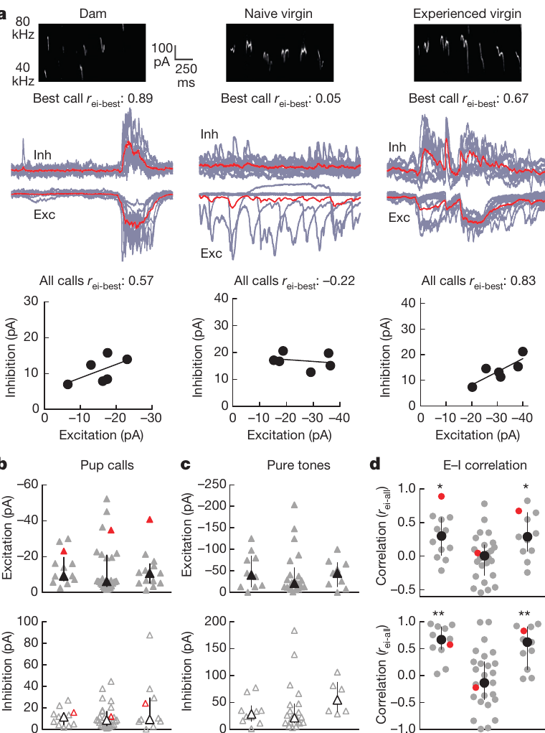
Matched excitation and inhibition sharpen call responses
An excitatory postsynaptic current promotes neuronal activation, whereas an inhibitory postsynaptic current opposes or constrains it. Voltage-clamp recordings hold membrane voltage at selected levels, so these call-evoked inputs can be examined separately in auditory cortical neurons. Excitation and inhibition are measured at the same neurons, so their balance is measured within each cell.
Mothers and experienced virgins had better matched timing and call selectivity of excitation and inhibition than inexperienced virgins. The amplitudes of the synaptic responses were broadly comparable, which points to a change in how the two inputs are timed relative to each other. The matched timing of the two currents is the feature that distinguishes mothers and experienced virgins.
Excitation–inhibition balance here means coordinated patterns across time and calls. Recordings made under separate conditions support this relationship, and simultaneous recordings of both currents within one trial would show it directly. Coordinated timing of the two inputs shapes which calls drive the neuron, which explains the selectivity change.
Marlin et al. (2015), Fig. 2(d,e). Receptor-positive cortical cells and interneurons; bars 50 µm.
Marlin et al. (2015), Fig. 5(a–d). Call-evoked excitation and inhibition in cortical neurons.
Marlin et al. (2015)
44
Notes:
An excitatory postsynaptic current promotes neuronal activation, whereas an inhibitory postsynaptic current opposes or constrains it. Voltage-clamp recordings hold membrane voltage at selected levels so these call-evoked inputs can be examined separately in auditory cortical neurons.
Mothers and experienced virgins had better matched timing and call selectivity of excitation and inhibition than inexperienced virgins. The amplitudes of synaptic responses were broadly comparable, arguing against a simple explanation based only on stronger excitatory input.
Excitation–inhibition balance here means coordinated patterns across time and calls, not cancellation of every current at every instant. Measurements from separate recording conditions support this relationship, but do not capture both currents simultaneously within the same individual trial.
References:
Marlin BJ, Mitre M, D’amour JA, Chao MV, Froemke RC (2015). Oxytocin enables maternal behaviour by balancing cortical inhibition. Nature 520:499–504. https://doi.org/10.1038/nature14402
Figure sources:
Marlin et al. (2015), Fig. 5(a–d). Call-evoked excitation and inhibition in cortical neurons. https://doi.org/10.1038/nature14402
Marlin et al. (2015), Fig. 2(d,e). Receptor-positive cortical cells and interneurons; bars 50 µm. https://doi.org/10.1038/nature14402

Slide 59
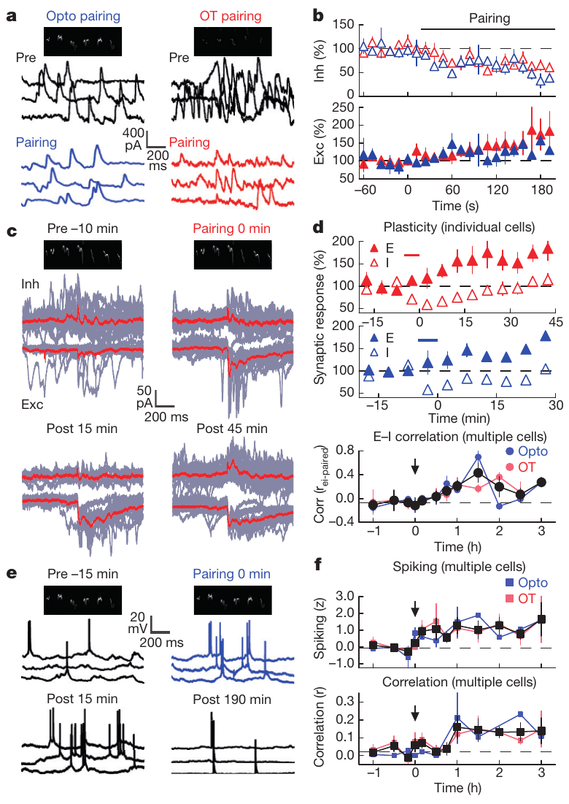
Oxytocin opens a window for lasting synaptic change
Marlin and colleagues paired pup calls with oxytocin application or with stimulation of oxytocin axons. Inhibition decreased rapidly, within about 40–60 seconds, which allowed a temporary change in the balance of inputs during exposure to the vocal signal. The inhibition drop occurred during the calls, so it limited the inhibitory input at the moment the signal arrived.
Over subsequent minutes to hours, excitation and inhibition became better matched to the paired calls, and spiking became stronger and more temporally reliable. Inhibitory responses recovered while the improved coordination persisted, which distinguishes an early permissive change from the later learned circuit state. The consolidation of the excitation-inhibition match persisted after the inhibition had recovered.
The evidence supports neuromodulation of plasticity rather than permanent removal of inhibition. The experiments were carried out in mouse auditory cortex, and the same principle, that hormonal state changes sensory responsiveness, is the basis for testing these mechanisms in other species. Hormone-driven plasticity in cortex therefore depends on the timing of hormone release relative to the sensory input.
Marlin et al. (2015), Fig. 2(d,e). Receptor-positive cortical cells and interneurons; bars 50 µm.
Marlin et al. (2015), Fig. 6(a–f). Oxytocin pairing and subsequent synaptic and spike plasticity.
Marlin et al. (2015)
45
Notes:
Marlin and colleagues paired pup calls with oxytocin application or stimulation of oxytocin axons. Inhibition decreased rapidly, within approximately 40–60 seconds, permitting a temporary change in the balance of inputs during exposure to the vocal signal.
Over subsequent minutes to hours, excitation and inhibition became better matched to the paired calls, and spiking became stronger and more temporally reliable. Inhibitory responses recovered while the improved coordination persisted, separating an early permissive change from the later learned circuit state.
The evidence supports neuromodulation of plasticity rather than permanent removal of inhibition. These are mouse auditory-cortex experiments; the comparable general principle that hormonal state changes sensory responsiveness does not establish the same receptor or synaptic mechanism in ring doves or seasonal songbirds.
References:
Marlin BJ, Mitre M, D’amour JA, Chao MV, Froemke RC (2015). Oxytocin enables maternal behaviour by balancing cortical inhibition. Nature 520:499–504. https://doi.org/10.1038/nature14402
Figure sources:
Marlin et al. (2015), Fig. 6(a–f). Oxytocin pairing and subsequent synaptic and spike plasticity. https://doi.org/10.1038/nature14402
Marlin et al. (2015), Fig. 2(d,e). Receptor-positive cortical cells and interneurons; bars 50 µm. https://doi.org/10.1038/nature14402

Slide 60
Key takeaways
Hormones and experience interact. Prolactin-induced feeding depends on reproductive history and sensory conditions; a physiological response is not a complete behavioral program.
Reproductive coordination is reciprocal. Estrogen–progesterone treatment facilitates female nesting and incubation and changes behavior in untreated male partners.
Vocal behavior feeds back on physiology. Own-coo playback rescues follicular growth in muted females, supporting an acoustic contribution without excluding bodily feedback.
Seasonal plasticity is region-specific. Breeding-like conditions rapidly increase HVC neuron number; RA and Area X expand later, with different cellular signatures.
Anatomical sequence is not causal proof. Song consistency increases as circuitry develops, but sequential growth alone does not establish a particular trophic mechanism.
Hormones can facilitate sensory learning. In mice, oxytocin transiently reduces cortical inhibition and promotes lasting call-response coordination; acquisition and established performance have different dependencies.
Notes:
Hormones and experience interact. Prolactin-induced feeding depends on reproductive history and sensory conditions; a physiological response is not a complete behavioral program.
Reproductive coordination is reciprocal. Estrogen–progesterone treatment facilitates female nesting and incubation and changes behavior in untreated male partners.
Vocal behavior feeds back on physiology. Own-coo playback rescues follicular growth in muted females, supporting an acoustic contribution without excluding bodily feedback.
Seasonal plasticity is region-specific. Breeding-like conditions rapidly increase HVC neuron number; RA and Area X expand later, with different cellular signatures.
Anatomical sequence is not causal proof. Song consistency increases as circuitry develops, but sequential growth alone does not establish a particular trophic mechanism.
Hormones can facilitate sensory learning. In mice, oxytocin transiently reduces cortical inhibition and promotes lasting call-response coordination; acquisition and established performance have different dependencies.
References:
Lehrman DS (1955). The physiological basis of parental feeding behavior in the ring dove (Streptopelia risoria). Behaviour 7:241–286. https://doi.org/10.1163/156853955X00094
Cheng MF, Silver R (1975). Estrogen-progesterone regulation of nest-building and incubation behavior in ovariectomized ring doves (Streptopelia risoria). Journal of Comparative and Physiological Psychology 88:256–263. https://doi.org/10.1037/h0076181
Cheng MF (1986). Female cooing promotes ovarian development in ring doves. Physiology & Behavior 37:371–374. https://doi.org/10.1016/0031-9384(86)90248-9
Nottebohm F (1981). A brain for all seasons: Cyclical anatomical changes in song control nuclei of the canary brain. Science 214:1368–1370. https://doi.org/10.1126/science.7313697
Tramontin AD, Hartman VN, Brenowitz EA (2000). Breeding conditions induce rapid and sequential growth in adult avian song control circuits: A model of seasonal plasticity in the brain. Journal of Neuroscience 20:854–861. https://doi.org/10.1523/JNEUROSCI.20-02-00854.2000
Marlin BJ, Mitre M, D’amour JA, Chao MV, Froemke RC (2015). Oxytocin enables maternal behaviour by balancing cortical inhibition. Nature 520:499–504. https://doi.org/10.1038/nature14402

