Slide 1

NEUR 411 · NEUROETHOLOGY · FALL 2026
Lecture 32
Vocal communication I: songbird song-system anatomy — HVC–RA–Area X (Nottebohm)
Monday, November 9, 2026
Jordan Lopez, Ph.D.
Professor of Neurobiology & Biomedical Engineering
Photo: Male and female zebra finches.
Notes:
• Vocal communication I: songbird song-system anatomy — HVC–RA–Area X (Nottebohm)
• Male zebra finches provide an experimentally tractable model of learned vocal motor behavior. Canary lesion experiments established foundational pathways controlling song.
• The title photograph is credited to Michael Hains, CC BY-NC 4.0. https://www.inaturalist.org/photos/147702462
References:
Nottebohm F, Stokes TM, Leonard CM (1976). Central control of song in the canary, Serinus canarius. Journal of Comparative Neurology 165(4):457-486. https://doi.org/10.1002/cne.901650405
Bottjer SW, Miesner EA, Arnold AP (1984). Forebrain Lesions Disrupt Development But Not Maintenance of Song in Passerine Birds. Science 224(4651):901-903. https://doi.org/10.1126/science.6719123
Benezra SE, Narayanan RT, Egger R, Oberlaender M, Long MA (2018). Morphological characterization of HVC projection neurons in the zebra finch (Taeniopygia guttata). Journal of Comparative Neurology 526(10):1673-1689. https://doi.org/10.1002/cne.24437
Doupe AJ (1997). Song- and Order-Selective Neurons in the Songbird Anterior Forebrain and their Emergence during Vocal Development. The Journal of Neuroscience 17(3):1147-1167. https://doi.org/10.1523/jneurosci.17-03-01147.1997

Slide 2
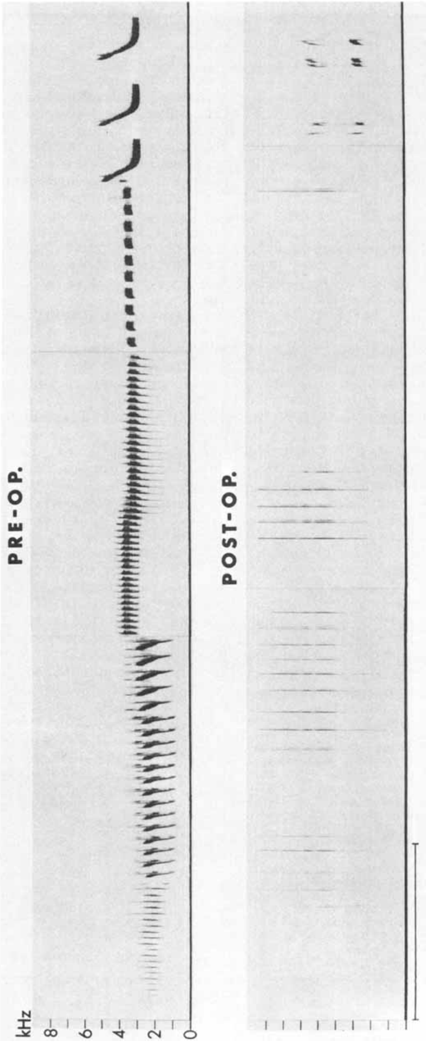
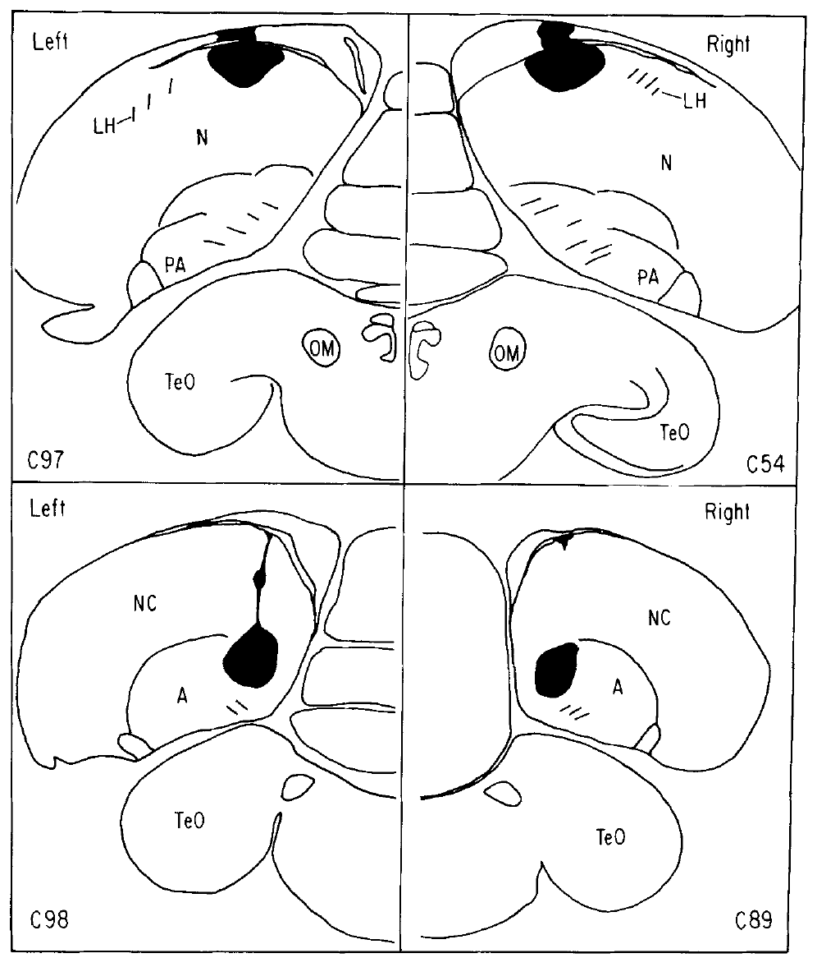
Song is a learned, organized motor sequence
Song consists of coordinated vocal elements whose frequency and timing can be measured with a spectrogram, a display of acoustic energy across time and frequency. Nottebohm and colleagues recorded adult male canaries before brain surgery, establishing each bird's own repertoire as the behavioral baseline.
They compared postoperative vocalizations with those recordings rather than treating all changes in singing as equivalent. Damage could reduce the number of available syllables, disturb their acoustic structure, or disrupt the organization of phrases while leaving vocal output possible.
A bird that still vocalizes can therefore have a severe song-control deficit. These experiments localized components of an established motor behavior; adult lesions alone did not identify where a juvenile stores or learns a tutor's song.
Nottebohm et al. (1976), Fig. 13. Canary song before and after a forebrain lesion.
Nottebohm et al. (1976), Fig. 11. Lesion locations associated with song disruption.
Nottebohm et al. (1976)
02
Notes:
• Song consists of coordinated vocal elements whose frequency and timing can be measured with a spectrogram, a display of acoustic energy across time and frequency. Nottebohm and colleagues recorded adult male canaries before brain surgery, establishing each bird's own repertoire as the behavioral baseline.
• They compared postoperative vocalizations with those recordings rather than treating all changes in singing as equivalent. Damage could reduce the number of available syllables, disturb their acoustic structure, or disrupt the organization of phrases while leaving vocal output possible.
• A bird that still vocalizes can therefore have a severe song-control deficit. These experiments localized components of an established motor behavior; adult lesions alone did not identify where a juvenile stores or learns a tutor's song.
References:
Nottebohm F, Stokes TM, Leonard CM (1976). Central control of song in the canary, Serinus canarius. Journal of Comparative Neurology 165(4):457-486. https://doi.org/10.1002/cne.901650405
Figure: Nottebohm et al. (1976), Fig. 13. Canary song before and after a forebrain lesion.
Figure source: https://doi.org/10.1002/cne.901650405
Figure: Nottebohm et al. (1976), Fig. 11. Lesion locations associated with song disruption.
Figure source: https://doi.org/10.1002/cne.901650405

Slide 3
Song disruption depends on lesion location
A lesion is damage to tissue used to test whether a region contributes to a behavior. Nottebohm and colleagues made unilateral electrolytic lesions in adult male canaries and reconstructed their positions histologically after repeated postoperative song recordings.
Lesions involving HVC or the robust nucleus of the arcopallium, RA, severely altered song organization, whereas several lesions outside the implicated pathway had little or no effect. Comparing effective and ineffective lesion sites constrained the anatomical interpretation beyond a simple surgery-versus-no-surgery comparison.
Electrolytic current can damage both local neurons and passing axons. The results establish that these restricted forebrain territories are necessary for normal adult song, but do not isolate a particular cell type or prove that every nucleus performs the same computation.
Nottebohm et al. (1976), Fig. 11. Lesion locations associated with song disruption.
Nottebohm et al. (1976)
03
Notes:
• A lesion is damage to tissue used to test whether a region contributes to a behavior. Nottebohm and colleagues made unilateral electrolytic lesions in adult male canaries and reconstructed their positions histologically after repeated postoperative song recordings.
• Lesions involving HVC or the robust nucleus of the arcopallium, RA, severely altered song organization, whereas several lesions outside the implicated pathway had little or no effect. Comparing effective and ineffective lesion sites constrained the anatomical interpretation beyond a simple surgery-versus-no-surgery comparison.
• Electrolytic current can damage both local neurons and passing axons. The results establish that these restricted forebrain territories are necessary for normal adult song, but do not isolate a particular cell type or prove that every nucleus performs the same computation.
References:
Nottebohm F, Stokes TM, Leonard CM (1976). Central control of song in the canary, Serinus canarius. Journal of Comparative Neurology 165(4):457-486. https://doi.org/10.1002/cne.901650405
Figure: Nottebohm et al. (1976), Fig. 11. Lesion locations associated with song disruption.
Figure source: https://doi.org/10.1002/cne.901650405

Slide 4
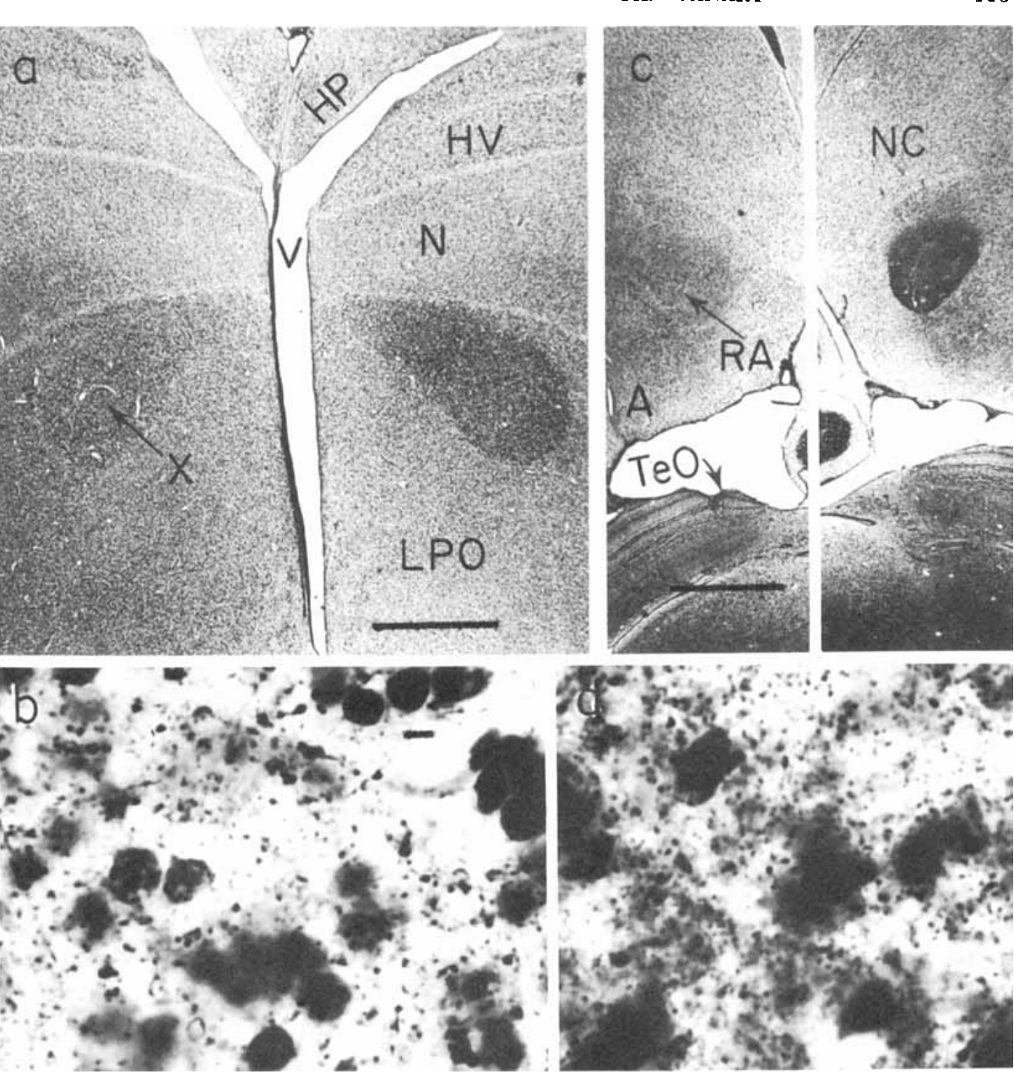
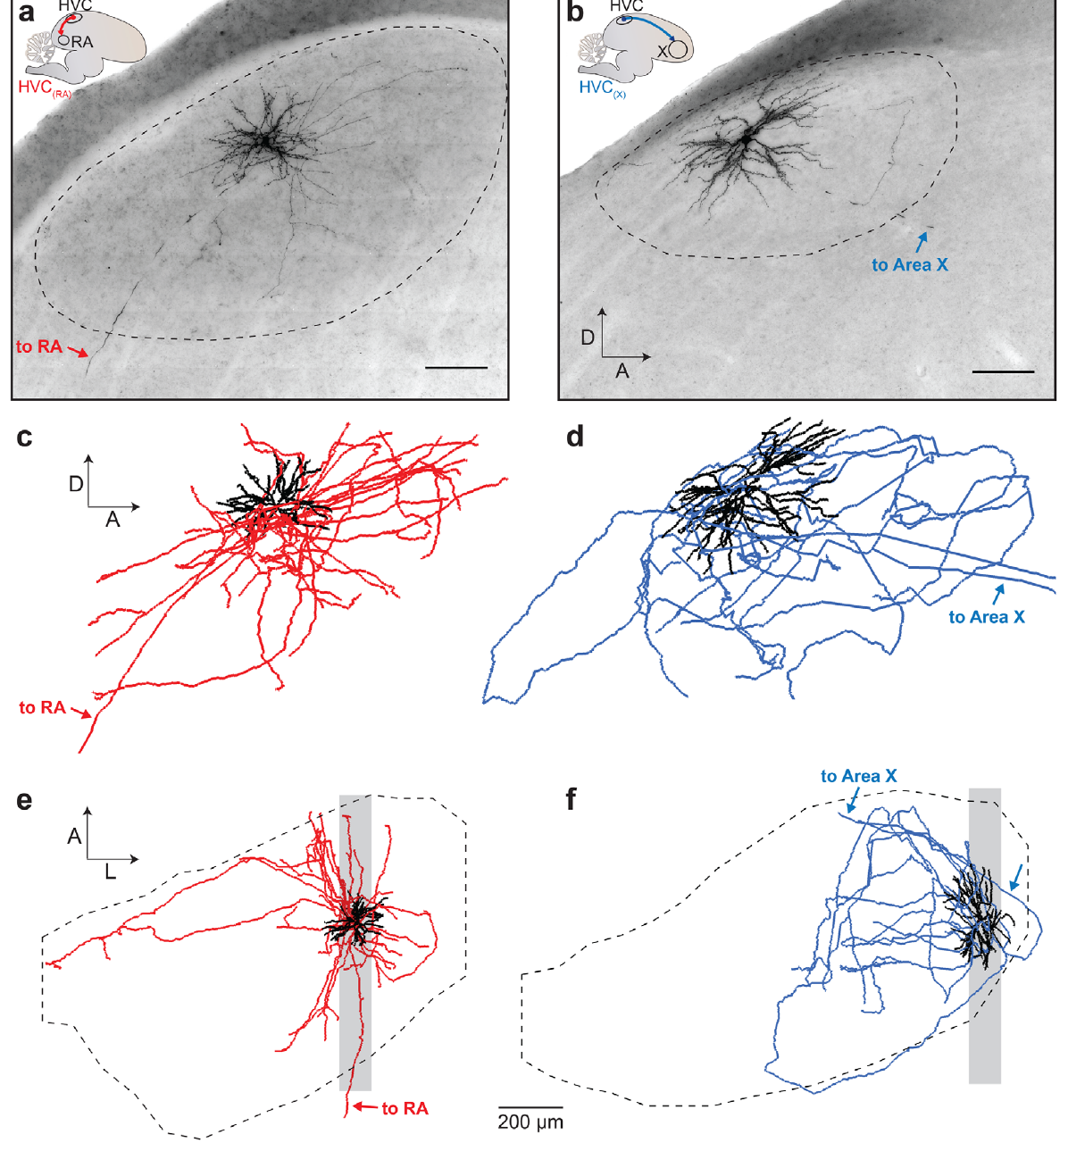
Degenerating axons reveal descending song pathways
An axon carries signals away from a neuron; a projection is an axonal connection between regions. A synapse is a junction through which a neuron influences another cell. Nottebohm and colleagues combined behavioral lesions with Fink–Heimer staining, a method that reveals degenerating fibers and terminals downstream of damaged neurons.
Degeneration linked the region historically called HVc to RA and connected RA with descending pathways toward vocal motor structures. Comparing the locations of lesions with the distributions of degeneration supplied anatomical evidence independent of the acoustic changes in song.
The historical names in the original article differ from current avian terminology: HVC is now used as a proper name, and RA lies in the arcopallium. Degeneration tracing establishes a pathway's anatomical direction, but does not measure its transmitter, synaptic sign, or activity during singing.
Nottebohm et al. (1976), Fig. 7(a–d). Degeneration staining in the canary song pathway.
Benezra et al. (2018), Fig. 2(a–f). Identified RA- and X-projecting HVC neurons.
Nottebohm et al. (1976); Benezra et al. (2018)
04
Notes:
• An axon carries signals away from a neuron; a projection is an axonal connection between regions. A synapse is a junction through which a neuron influences another cell. Nottebohm and colleagues combined behavioral lesions with Fink–Heimer staining, a method that reveals degenerating fibers and terminals downstream of damaged neurons.
• Degeneration linked the region historically called HVc to RA and connected RA with descending pathways toward vocal motor structures. Comparing the locations of lesions with the distributions of degeneration supplied anatomical evidence independent of the acoustic changes in song.
• The historical names in the original article differ from current avian terminology: HVC is now used as a proper name, and RA lies in the arcopallium. Degeneration tracing establishes a pathway's anatomical direction, but does not measure its transmitter, synaptic sign, or activity during singing.
References:
Nottebohm F, Stokes TM, Leonard CM (1976). Central control of song in the canary, Serinus canarius. Journal of Comparative Neurology 165(4):457-486. https://doi.org/10.1002/cne.901650405
Benezra SE, Narayanan RT, Egger R, Oberlaender M, Long MA (2018). Morphological characterization of HVC projection neurons in the zebra finch (Taeniopygia guttata). Journal of Comparative Neurology 526(10):1673-1689. https://doi.org/10.1002/cne.24437
Figure: Nottebohm et al. (1976), Fig. 7(a–d). Degeneration staining in the canary song pathway.
Figure source: https://doi.org/10.1002/cne.901650405
Figure: Benezra et al. (2018), Fig. 2(a–f). Identified RA- and X-projecting HVC neurons.
Figure source: https://doi.org/10.1002/cne.24437

Slide 5
HVC contains neurons with distinct output targets
A projection neuron sends an axon outside its local region. Benezra and colleagues distinguished HVC neurons projecting to RA, designated HVC(RA), from neurons projecting to Area X, a song-related basal ganglia region involved in action control, designated HVC(X).
They labeled individual cells in adult male zebra finches and reconstructed their dendrites and axons in three dimensions. The analysis retained the target identity of each filled neuron rather than pooling every HVC cell into a single morphological population.
HVC(RA) and HVC(X) neurons differed in their dendritic and local axonal organization, although target identity did not perfectly predict every anatomical feature. Separate output classes allow HVC to influence vocal execution and the anterior forebrain pathway; morphology alone does not reveal the precise signals transmitted along either branch.
Benezra et al. (2018), Fig. 2(a–f). Identified RA- and X-projecting HVC neurons.
Benezra et al. (2018)
05
Notes:
• A projection neuron sends an axon outside its local region. Benezra and colleagues distinguished HVC neurons projecting to RA, designated HVC(RA), from neurons projecting to Area X, a song-related basal ganglia region involved in action control, designated HVC(X).
• They labeled individual cells in adult male zebra finches and reconstructed their dendrites and axons in three dimensions. The analysis retained the target identity of each filled neuron rather than pooling every HVC cell into a single morphological population.
• HVC(RA) and HVC(X) neurons differed in their dendritic and local axonal organization, although target identity did not perfectly predict every anatomical feature. Separate output classes allow HVC to influence vocal execution and the anterior forebrain pathway; morphology alone does not reveal the precise signals transmitted along either branch.
References:
Benezra SE, Narayanan RT, Egger R, Oberlaender M, Long MA (2018). Morphological characterization of HVC projection neurons in the zebra finch (Taeniopygia guttata). Journal of Comparative Neurology 526(10):1673-1689. https://doi.org/10.1002/cne.24437
Figure: Benezra et al. (2018), Fig. 2(a–f). Identified RA- and X-projecting HVC neurons.
Figure source: https://doi.org/10.1002/cne.24437

Slide 6
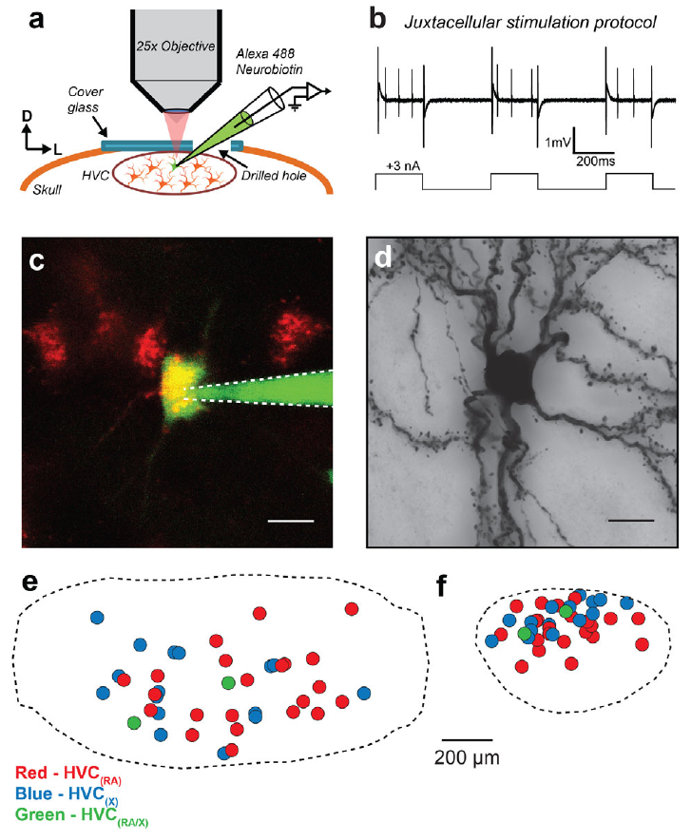
Two-photon targeting links cells to reconstructed arbors
Two-photon microscopy uses nonlinear excitation to resolve fluorescent structures within tissue. Benezra and colleagues combined retrograde labeling from an HVC output target with visually guided recordings and intracellular filling, connecting a neuron's projection identity with its later anatomical reconstruction.
A fluorescently filled neuron was processed histologically so that its dendrites and axonal branches could be traced across sections. This approach resolved single-cell structure that would be obscured if many neighboring neurons were labeled together.
Targeted filling provides a bridge between an identified neuron and its complete local arbor. However, incomplete filling, section boundaries, and finite optical resolution can hide fine processes; the resulting anatomical map is not a direct measurement of every functional synapse.
Benezra et al. (2018), Fig. 1(a–f). Targeted labeling and single-cell filling in HVC.
Benezra et al. (2018)
06
Notes:
• Two-photon microscopy uses nonlinear excitation to resolve fluorescent structures within tissue. Benezra and colleagues combined retrograde labeling from an HVC output target with visually guided recordings and intracellular filling, connecting a neuron's projection identity with its later anatomical reconstruction.
• A fluorescently filled neuron was processed histologically so that its dendrites and axonal branches could be traced across sections. This approach resolved single-cell structure that would be obscured if many neighboring neurons were labeled together.
• Targeted filling provides a bridge between an identified neuron and its complete local arbor. However, incomplete filling, section boundaries, and finite optical resolution can hide fine processes; the resulting anatomical map is not a direct measurement of every functional synapse.
References:
Benezra SE, Narayanan RT, Egger R, Oberlaender M, Long MA (2018). Morphological characterization of HVC projection neurons in the zebra finch (Taeniopygia guttata). Journal of Comparative Neurology 526(10):1673-1689. https://doi.org/10.1002/cne.24437
Figure: Benezra et al. (2018), Fig. 1(a–f). Targeted labeling and single-cell filling in HVC.
Figure source: https://doi.org/10.1002/cne.24437

Slide 7
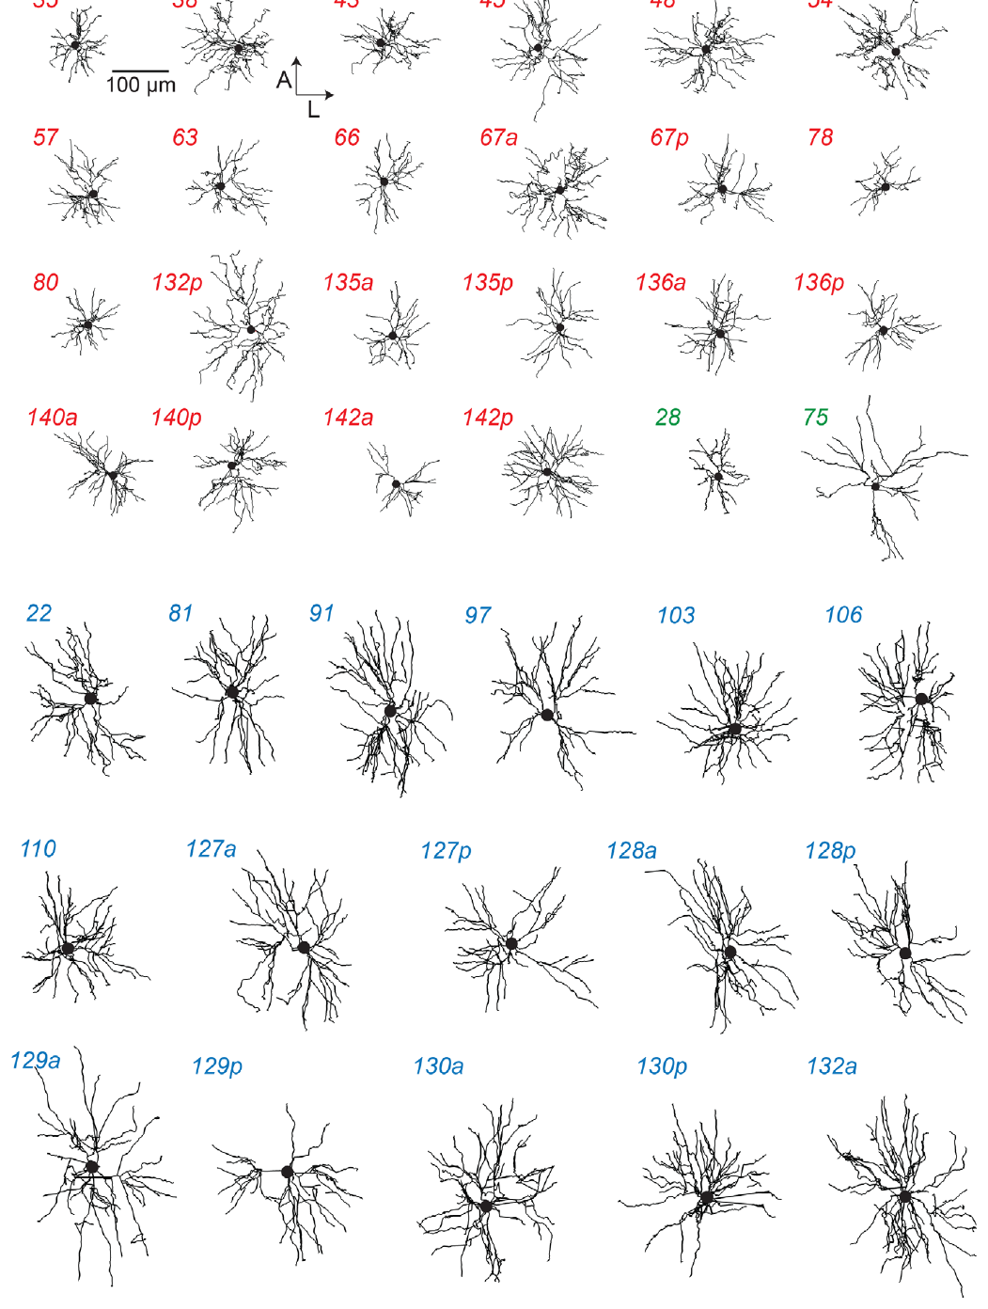
Dendrites occupy different territories in HVC
A dendrite is a neuronal process that receives synaptic input. Benezra and colleagues compared reconstructed dendritic trees of HVC(RA) and HVC(X) neurons after registering their positions within HVC, allowing cell types to be compared in a common anatomical frame.
Most RA-projecting cells had relatively restricted dendritic territories, whereas X-projecting cells occupied larger territories. Displaying individual reconstructions preserved variation within each class rather than replacing the cells with an idealized average neuron.
A broader dendritic field creates access to a different spatial distribution of potential inputs, but proximity is not equivalent to connectivity. The study measured anatomy, not the identities, strengths, or timing of all inputs contacting each dendritic branch during natural song.
Benezra et al. (2018), Fig. 3. Dendritic arbors grouped by projection target.
Benezra et al. (2018)
07
Notes:
• A dendrite is a neuronal process that receives synaptic input. Benezra and colleagues compared reconstructed dendritic trees of HVC(RA) and HVC(X) neurons after registering their positions within HVC, allowing cell types to be compared in a common anatomical frame.
• Most RA-projecting cells had relatively restricted dendritic territories, whereas X-projecting cells occupied larger territories. Displaying individual reconstructions preserved variation within each class rather than replacing the cells with an idealized average neuron.
• A broader dendritic field creates access to a different spatial distribution of potential inputs, but proximity is not equivalent to connectivity. The study measured anatomy, not the identities, strengths, or timing of all inputs contacting each dendritic branch during natural song.
References:
Benezra SE, Narayanan RT, Egger R, Oberlaender M, Long MA (2018). Morphological characterization of HVC projection neurons in the zebra finch (Taeniopygia guttata). Journal of Comparative Neurology 526(10):1673-1689. https://doi.org/10.1002/cne.24437
Figure: Benezra et al. (2018), Fig. 3. Dendritic arbors grouped by projection target.
Figure source: https://doi.org/10.1002/cne.24437

Slide 8
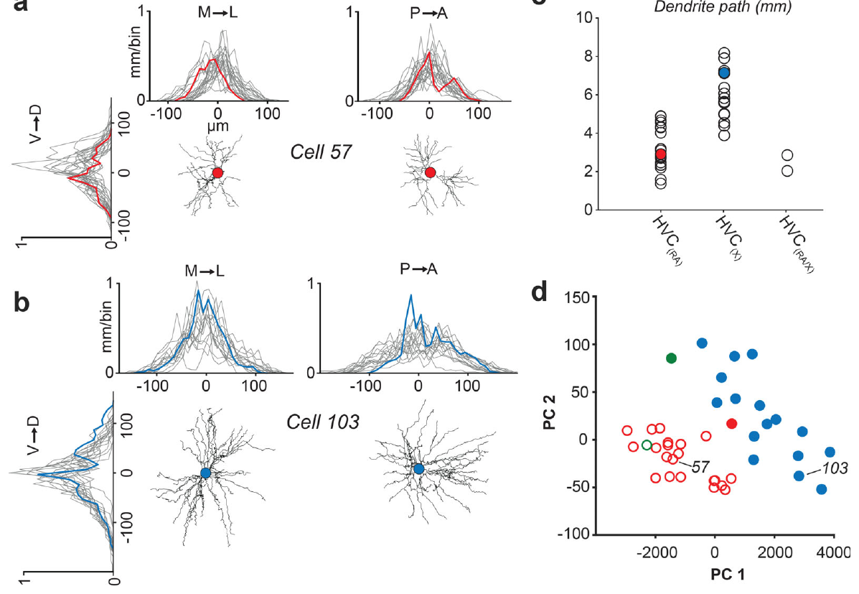
Target identity predicts dendritic scale imperfectly
Benezra and colleagues quantified dendritic length along three spatial axes and the total path length of reconstructed HVC neurons. Centering these measurements on each cell body separated dendritic extent from the neuron's absolute position within the nucleus.
RA-projecting neurons generally formed a smaller-dendrite group, whereas X-projecting neurons formed a larger-dendrite group. The distributions nevertheless included exceptions, and cells with branches to both targets did not constitute a single uniform size class.
These measurements constrain the spatial integration available to each projection population. They do not justify assigning every small neuron a motor function or every large neuron a learning function without identifying its actual axonal target; anatomical classes overlap in some features even when their average organization differs.
Benezra et al. (2018), Fig. 4(a–d). Spatial distribution and size of HVC dendrites.
Benezra et al. (2018)
08
Notes:
• Benezra and colleagues quantified dendritic length along three spatial axes and the total path length of reconstructed HVC neurons. Centering these measurements on each cell body separated dendritic extent from the neuron's absolute position within the nucleus.
• RA-projecting neurons generally formed a smaller-dendrite group, whereas X-projecting neurons formed a larger-dendrite group. The distributions nevertheless included exceptions, and cells with branches to both targets did not constitute a single uniform size class.
• These measurements constrain the spatial integration available to each projection population. They do not justify assigning every small neuron a motor function or every large neuron a learning function without identifying its actual axonal target; anatomical classes overlap in some features even when their average organization differs.
References:
Benezra SE, Narayanan RT, Egger R, Oberlaender M, Long MA (2018). Morphological characterization of HVC projection neurons in the zebra finch (Taeniopygia guttata). Journal of Comparative Neurology 526(10):1673-1689. https://doi.org/10.1002/cne.24437
Figure: Benezra et al. (2018), Fig. 4(a–d). Spatial distribution and size of HVC dendrites.
Figure source: https://doi.org/10.1002/cne.24437

Slide 9
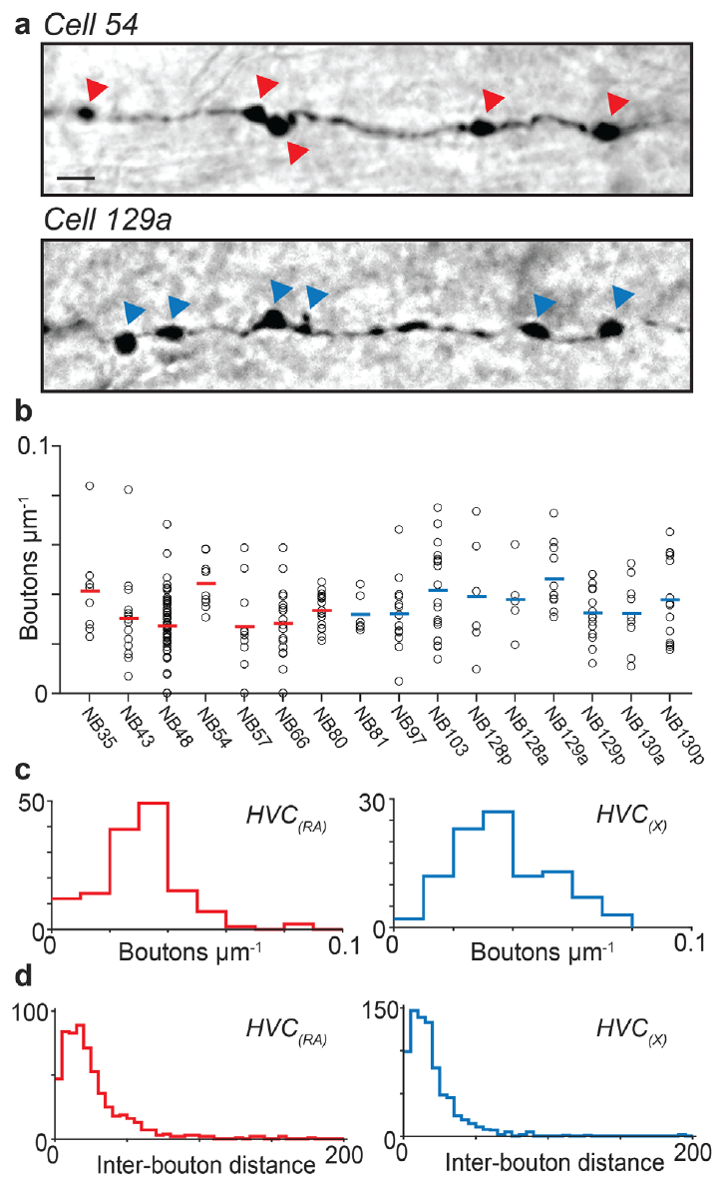
Axonal boutons mark potential local output sites
An axon collateral is a branch of an axon, and a bouton is a swelling associated with a potential presynaptic terminal. Benezra and colleagues counted boutons along reconstructed local collateral branches of HVC(RA) and HVC(X) neurons.
Both projection classes carried abundant boutons within HVC, with broadly similar bouton densities. Their reconstruction-based estimate was about 400 local boutons per HVC(RA) neuron. The labeled micrographs preserve a 5 µm scale bar, making the spatial separation of adjacent swellings explicit rather than implying that a whole branch acts as one output site.
Long-range projection neurons can therefore contribute to local HVC communication as well as sending signals downstream. Light-microscopic boutons are anatomical candidates for synapses; their presence does not identify the postsynaptic cell or establish the strength and sign of a particular connection.
Benezra et al. (2018), Fig. 5(a–d). Axonal boutons and their spatial density.
Benezra et al. (2018)
09
Notes:
• An axon collateral is a branch of an axon, and a bouton is a swelling associated with a potential presynaptic terminal. Benezra and colleagues counted boutons along reconstructed local collateral branches of HVC(RA) and HVC(X) neurons.
• Both projection classes carried abundant boutons within HVC, with broadly similar bouton densities. Their reconstruction-based estimate was about 400 local boutons per HVC(RA) neuron. The labeled micrographs preserve a 5 µm scale bar, making the spatial separation of adjacent swellings explicit rather than implying that a whole branch acts as one output site.
• Long-range projection neurons can therefore contribute to local HVC communication as well as sending signals downstream. Light-microscopic boutons are anatomical candidates for synapses; their presence does not identify the postsynaptic cell or establish the strength and sign of a particular connection.
References:
Benezra SE, Narayanan RT, Egger R, Oberlaender M, Long MA (2018). Morphological characterization of HVC projection neurons in the zebra finch (Taeniopygia guttata). Journal of Comparative Neurology 526(10):1673-1689. https://doi.org/10.1002/cne.24437
Figure: Benezra et al. (2018), Fig. 5(a–d). Axonal boutons and their spatial density.
Figure source: https://doi.org/10.1002/cne.24437

Slide 10
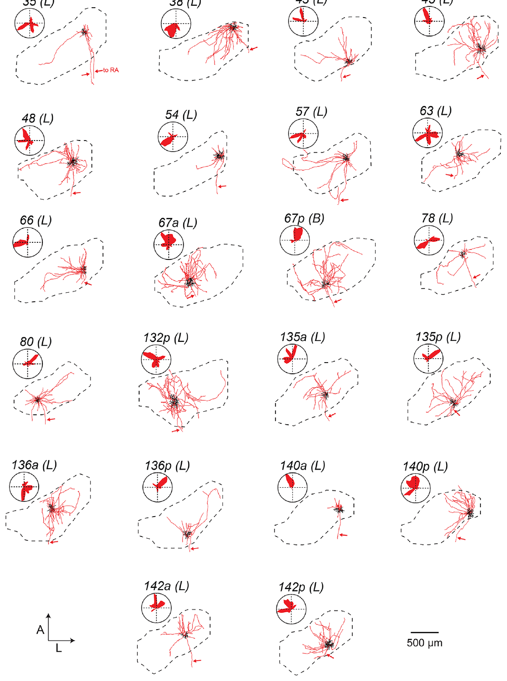
RA-projecting cells also innervate local HVC
Benezra and colleagues reconstructed the dendrites and axonal collaterals of individual HVC(RA) neurons within the boundary of HVC. The descending axon identified the cell's long-range destination, while its local branches provided a separate measure of intranuclear output.
Some cells confined most local axonal branches near the cell body, whereas others distributed branches across a broader portion of HVC. This variation remained visible within the RA-projecting population rather than being explained solely by differences between projection targets.
Local output makes a strictly feedforward description of HVC incomplete: an RA-projecting neuron can participate in HVC interactions before its axon reaches RA. The reconstruction does not determine whether the cell contacts another projection neuron, an inhibitory interneuron, or both.
Benezra et al. (2018), Fig. 6. Local axons of RA-projecting HVC neurons.
Benezra et al. (2018)
10
Notes:
• Benezra and colleagues reconstructed the dendrites and axonal collaterals of individual HVC(RA) neurons within the boundary of HVC. The descending axon identified the cell's long-range destination, while its local branches provided a separate measure of intranuclear output.
• Some cells confined most local axonal branches near the cell body, whereas others distributed branches across a broader portion of HVC. This variation remained visible within the RA-projecting population rather than being explained solely by differences between projection targets.
• Local output makes a strictly feedforward description of HVC incomplete: an RA-projecting neuron can participate in HVC interactions before its axon reaches RA. The reconstruction does not determine whether the cell contacts another projection neuron, an inhibitory interneuron, or both.
References:
Benezra SE, Narayanan RT, Egger R, Oberlaender M, Long MA (2018). Morphological characterization of HVC projection neurons in the zebra finch (Taeniopygia guttata). Journal of Comparative Neurology 526(10):1673-1689. https://doi.org/10.1002/cne.24437
Figure: Benezra et al. (2018), Fig. 6. Local axons of RA-projecting HVC neurons.
Figure source: https://doi.org/10.1002/cne.24437

Slide 11
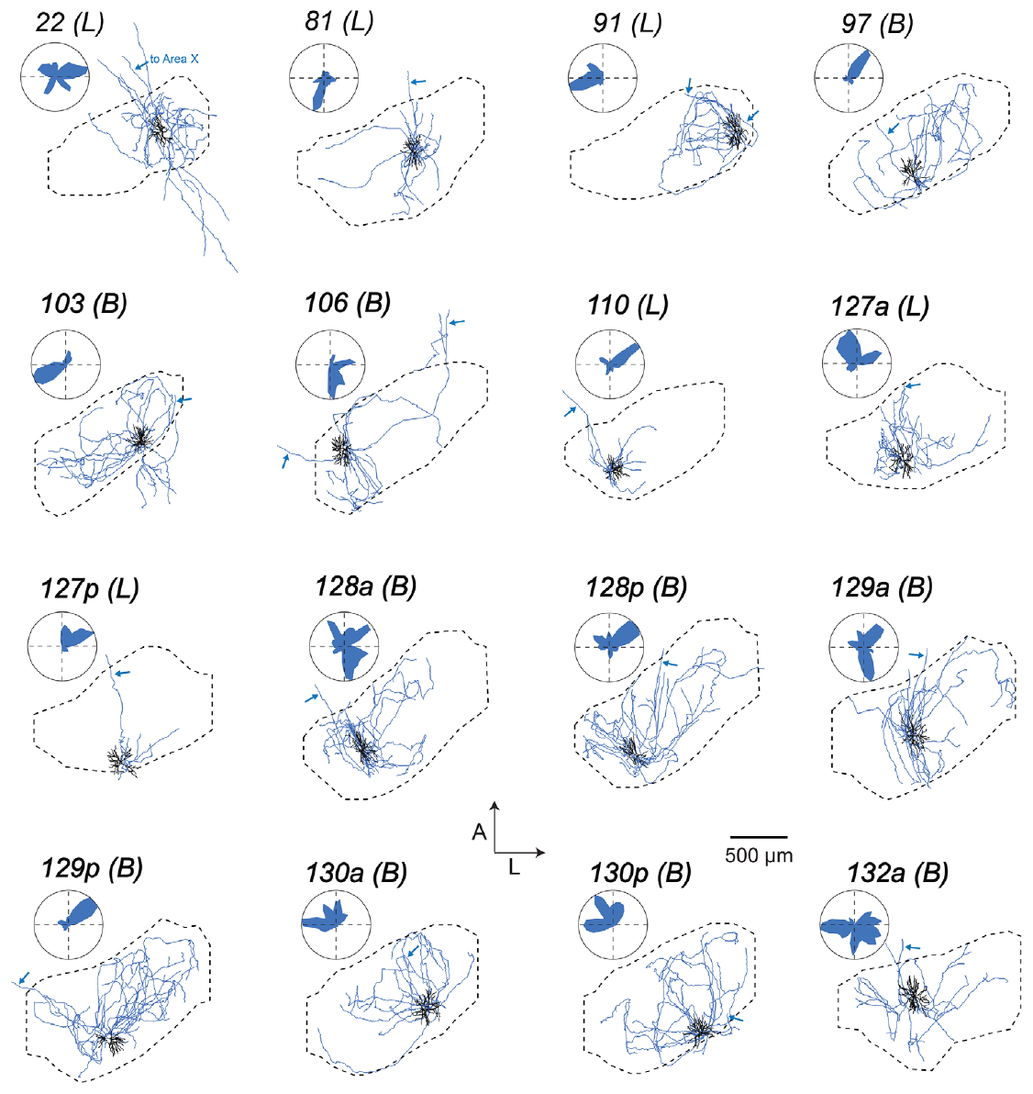
X-projecting cells have extensive local collaterals
Area X receives an HVC projection distinct from the direct HVC-to-RA motor pathway. Benezra and colleagues reconstructed HVC(X) neurons with their local axons, dendrites, and descending projection identified in the same preparation.
Their local branches varied from restricted arbors to broad distributions within HVC. The authors compared these distributions with RA-projecting cells in a shared reference frame, revealing organization that would be lost in a drawing of one generic HVC-to-X connection.
An HVC(X) neuron can consequently influence both the local HVC network and a distant basal ganglia region. The anatomical data support multiple routes for distributing activity, but do not establish whether particular local branches carry a timing signal, an auditory signal, or a mixture during behavior.
Benezra et al. (2018), Fig. 7. Local axons of X-projecting HVC neurons.
Benezra et al. (2018)
11
Notes:
• Area X receives an HVC projection distinct from the direct HVC-to-RA motor pathway. Benezra and colleagues reconstructed HVC(X) neurons with their local axons, dendrites, and descending projection identified in the same preparation.
• Their local branches varied from restricted arbors to broad distributions within HVC. The authors compared these distributions with RA-projecting cells in a shared reference frame, revealing organization that would be lost in a drawing of one generic HVC-to-X connection.
• An HVC(X) neuron can consequently influence both the local HVC network and a distant basal ganglia region. The anatomical data support multiple routes for distributing activity, but do not establish whether particular local branches carry a timing signal, an auditory signal, or a mixture during behavior.
References:
Benezra SE, Narayanan RT, Egger R, Oberlaender M, Long MA (2018). Morphological characterization of HVC projection neurons in the zebra finch (Taeniopygia guttata). Journal of Comparative Neurology 526(10):1673-1689. https://doi.org/10.1002/cne.24437
Figure: Benezra et al. (2018), Fig. 7. Local axons of X-projecting HVC neurons.
Figure source: https://doi.org/10.1002/cne.24437

Slide 12
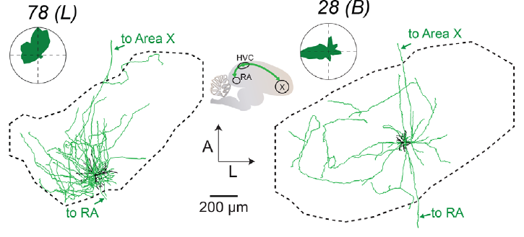
A few reconstructed cells project to both targets
Benezra and colleagues identified HVC neurons with axonal projections toward both RA and Area X. These HVC(RA/X) cells challenge an absolute rule that all long-range HVC outputs belong to two completely separate populations.
The reconstructed dual-projecting cells differed from one another in dendritic organization. The authors retained them as individually identified cells rather than forcing them into a single stereotyped anatomical class defined only by their shared target combination.
Dual projections provide a possible anatomical route for distributing related activity to motor and anterior forebrain pathways. Their existence does not establish how common such cells are throughout HVC, whether both branches transmit identical information, or whether they are necessary for coordinating the two pathways during singing.
Benezra et al. (2018), Fig. 8. Two dual-projecting HVC neurons.
Benezra et al. (2018)
12
Notes:
• Benezra and colleagues identified HVC neurons with axonal projections toward both RA and Area X. These HVC(RA/X) cells challenge an absolute rule that all long-range HVC outputs belong to two completely separate populations.
• The reconstructed dual-projecting cells differed from one another in dendritic organization. The authors retained them as individually identified cells rather than forcing them into a single stereotyped anatomical class defined only by their shared target combination.
• Dual projections provide a possible anatomical route for distributing related activity to motor and anterior forebrain pathways. Their existence does not establish how common such cells are throughout HVC, whether both branches transmit identical information, or whether they are necessary for coordinating the two pathways during singing.
References:
Benezra SE, Narayanan RT, Egger R, Oberlaender M, Long MA (2018). Morphological characterization of HVC projection neurons in the zebra finch (Taeniopygia guttata). Journal of Comparative Neurology 526(10):1673-1689. https://doi.org/10.1002/cne.24437
Figure: Benezra et al. (2018), Fig. 8. Two dual-projecting HVC neurons.
Figure source: https://doi.org/10.1002/cne.24437

Slide 13
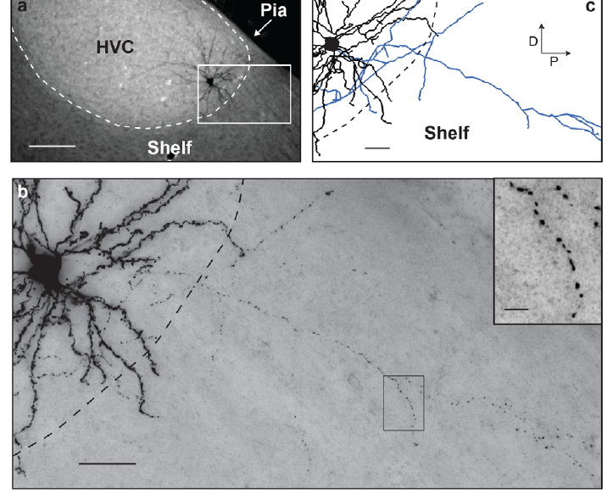
Some HVC processes extend into the surrounding shelf
The HVC shelf is tissue bordering HVC that is distinguished from the nucleus itself. Benezra and colleagues observed dendrites and axonal collaterals of an identified HVC(X) neuron extending beyond the conventional HVC boundary into this surrounding region.
Fluorescent and brightfield images were combined with reconstruction of the labeled processes. The original panels retain scale bars of 100 µm for the wider field and 25 µm and 5 µm for the detailed views, separating nuclear-scale anatomy from fine branches.
A histological boundary is therefore not necessarily a complete boundary for a neuron's connections. These processes provide anatomical access to adjacent tissue, but the study did not establish the sensory responses of their partners or prove a specific information flow between shelf and HVC.
Benezra et al. (2018), Fig. 9(a–c). Processes extending from HVC into the shelf.
Benezra et al. (2018)
13
Notes:
• The HVC shelf is tissue bordering HVC that is distinguished from the nucleus itself. Benezra and colleagues observed dendrites and axonal collaterals of an identified HVC(X) neuron extending beyond the conventional HVC boundary into this surrounding region.
• Fluorescent and brightfield images were combined with reconstruction of the labeled processes. The original panels retain scale bars of 100 µm for the wider field and 25 µm and 5 µm for the detailed views, separating nuclear-scale anatomy from fine branches.
• A histological boundary is therefore not necessarily a complete boundary for a neuron's connections. These processes provide anatomical access to adjacent tissue, but the study did not establish the sensory responses of their partners or prove a specific information flow between shelf and HVC.
References:
Benezra SE, Narayanan RT, Egger R, Oberlaender M, Long MA (2018). Morphological characterization of HVC projection neurons in the zebra finch (Taeniopygia guttata). Journal of Comparative Neurology 526(10):1673-1689. https://doi.org/10.1002/cne.24437
Figure: Benezra et al. (2018), Fig. 9(a–c). Processes extending from HVC into the shelf.
Figure source: https://doi.org/10.1002/cne.24437

Slide 14
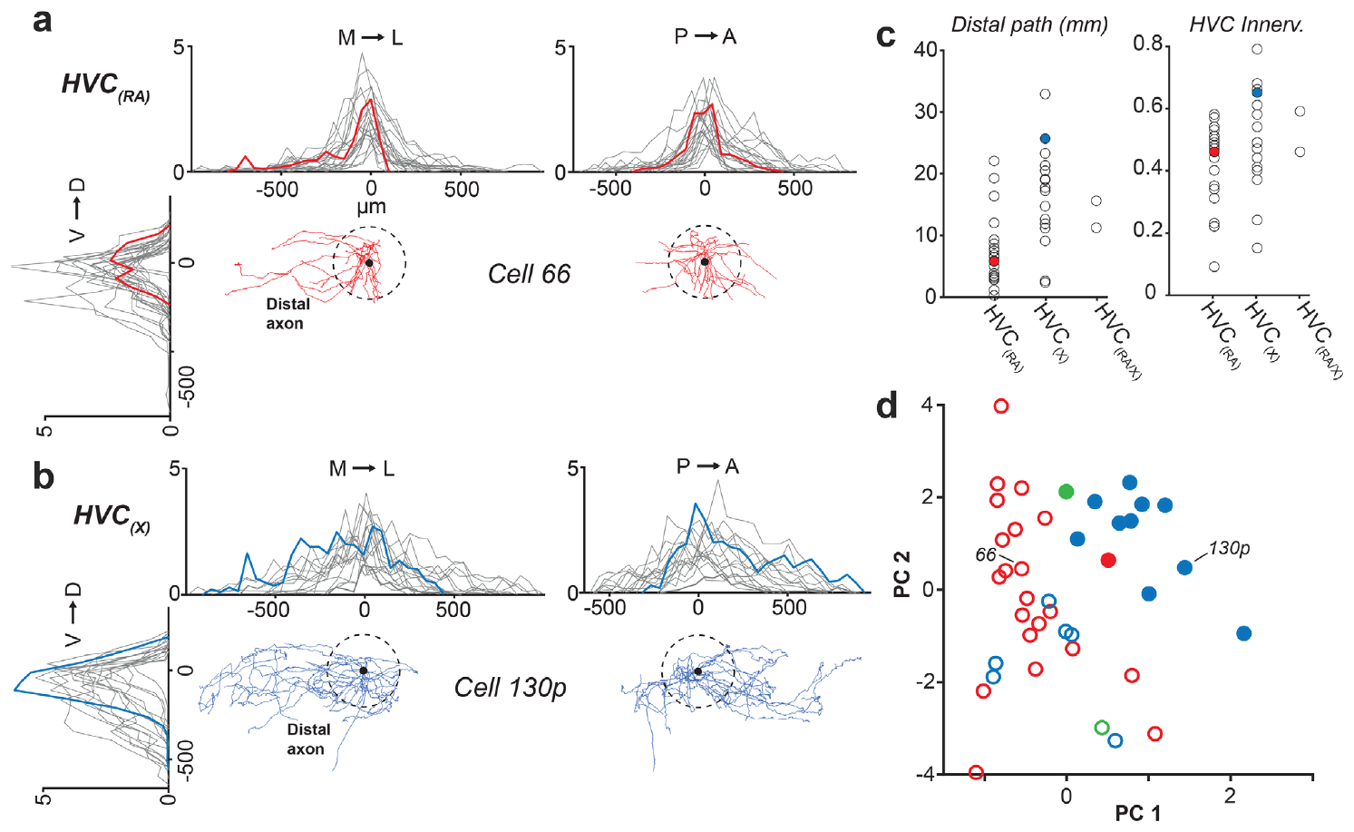
Local and broadcast axons differ within each class
A broadcast arbor distributes axonal branches across a relatively broad volume, whereas a local arbor remains more spatially restricted. Benezra and colleagues quantified HVC axonal extent and the proportion of the nucleus occupied by each reconstructed neuron.
Both RA-projecting and X-projecting populations contained cells with different local output territories. Quantifying axonal distribution separately from dendritic distribution prevented a large input field from being treated automatically as a large output field.
These anatomical differences constrain how activity might spread through the HVC network. The local-versus-broadcast distinction is a description of reconstructed geometry, not a demonstrated classification of neuronal function; identifying the actual partners and recording their responses would be necessary to establish the circuit consequences.
Benezra et al. (2018), Fig. 10(a–d). Local axonal distributions within HVC.
Benezra et al. (2018)
14
Notes:
• A broadcast arbor distributes axonal branches across a relatively broad volume, whereas a local arbor remains more spatially restricted. Benezra and colleagues quantified HVC axonal extent and the proportion of the nucleus occupied by each reconstructed neuron.
• Both RA-projecting and X-projecting populations contained cells with different local output territories. Quantifying axonal distribution separately from dendritic distribution prevented a large input field from being treated automatically as a large output field.
• These anatomical differences constrain how activity might spread through the HVC network. The local-versus-broadcast distinction is a description of reconstructed geometry, not a demonstrated classification of neuronal function; identifying the actual partners and recording their responses would be necessary to establish the circuit consequences.
References:
Benezra SE, Narayanan RT, Egger R, Oberlaender M, Long MA (2018). Morphological characterization of HVC projection neurons in the zebra finch (Taeniopygia guttata). Journal of Comparative Neurology 526(10):1673-1689. https://doi.org/10.1002/cne.24437
Figure: Benezra et al. (2018), Fig. 10(a–d). Local axonal distributions within HVC.
Figure source: https://doi.org/10.1002/cne.24437

Slide 15
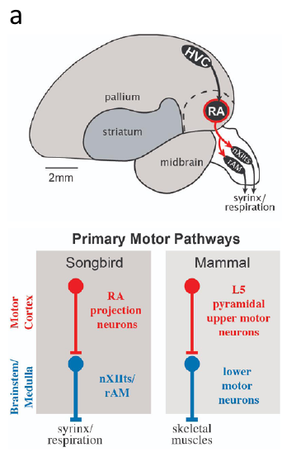
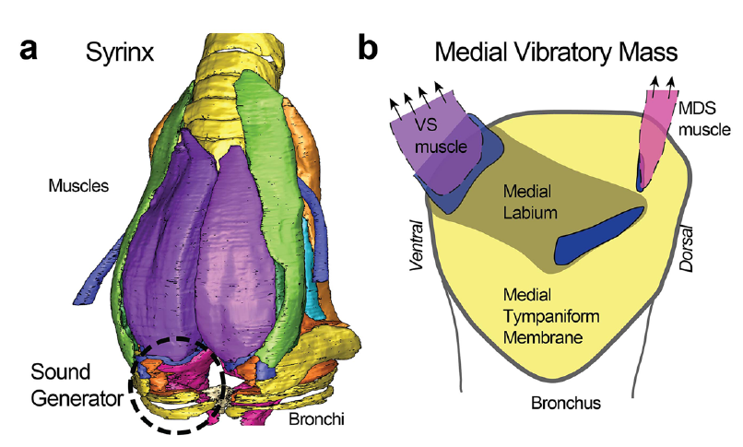
RA sends descending output to vocal motor structures
RA is a forebrain motor nucleus whose projection neurons provide descending output to brainstem targets. Zemel and colleagues place RA within the vocal motor pathway connecting HVC with the tracheosyringeal hypoglossal nucleus, nXIIts, and respiratory-related brainstem circuitry.
The syrinx is the avian vocal organ; its muscles are controlled by lower motor neurons rather than directly by RA cell bodies. RA activity thus reaches vocal musculature through descending axons and brainstem motor connections, coordinating sound production with respiratory activity.
Maxwell and colleagues controlled air pressures around an isolated zebra finch syrinx and elicited sound without an intact brain. This preparation separates the mechanical sound generator from its neural commands; an anatomically intact vocal organ does not by itself establish normal neural control of song.
Zemel et al. (2021), Fig. 1(a). RA and descending vocal motor pathways.
Maxwell et al. (2021), Fig. 1(a–b). Syrinx muscles and the medial vibratory mass.
Zemel et al. (2021); Maxwell et al. (2021)
15
Notes:
• RA is a forebrain motor nucleus whose projection neurons provide descending output to brainstem targets. Zemel and colleagues place RA within the vocal motor pathway connecting HVC with the tracheosyringeal hypoglossal nucleus, nXIIts, and respiratory-related brainstem circuitry.
• The syrinx is the avian vocal organ; its muscles are controlled by lower motor neurons rather than directly by RA cell bodies. RA activity thus reaches vocal musculature through descending axons and brainstem motor connections, coordinating sound production with respiratory activity.
• Maxwell and colleagues controlled air pressures around an isolated zebra finch syrinx and elicited sound without an intact brain. This preparation separates the mechanical sound generator from its neural commands; an anatomically intact vocal organ does not by itself establish normal neural control of song.
References:
Zemel BM, Nevue AA, Dagostin A, Lovell PV, Mello CV, von Gersdorff H (2021). Resurgent Na+ currents promote ultrafast spiking in projection neurons that drive fine motor control. Nature Communications 12(1):6762. https://doi.org/10.1038/s41467-021-26521-3
Maxwell A, Adam I, Larsen PS, Sørensen PG, Elemans CPH (2021). Syringeal vocal folds do not have a voice in zebra finch vocal development. Scientific Reports 11(1):6469. https://doi.org/10.1038/s41598-021-85929-5
Figure: Zemel et al. (2021), Fig. 1(a). RA and descending vocal motor pathways.
Figure source: https://doi.org/10.1038/s41467-021-26521-3
Figure: Maxwell et al. (2021), Fig. 1(a–b). Syrinx muscles and the medial vibratory mass.
Figure source: https://doi.org/10.1038/s41598-021-85929-5

Slide 16
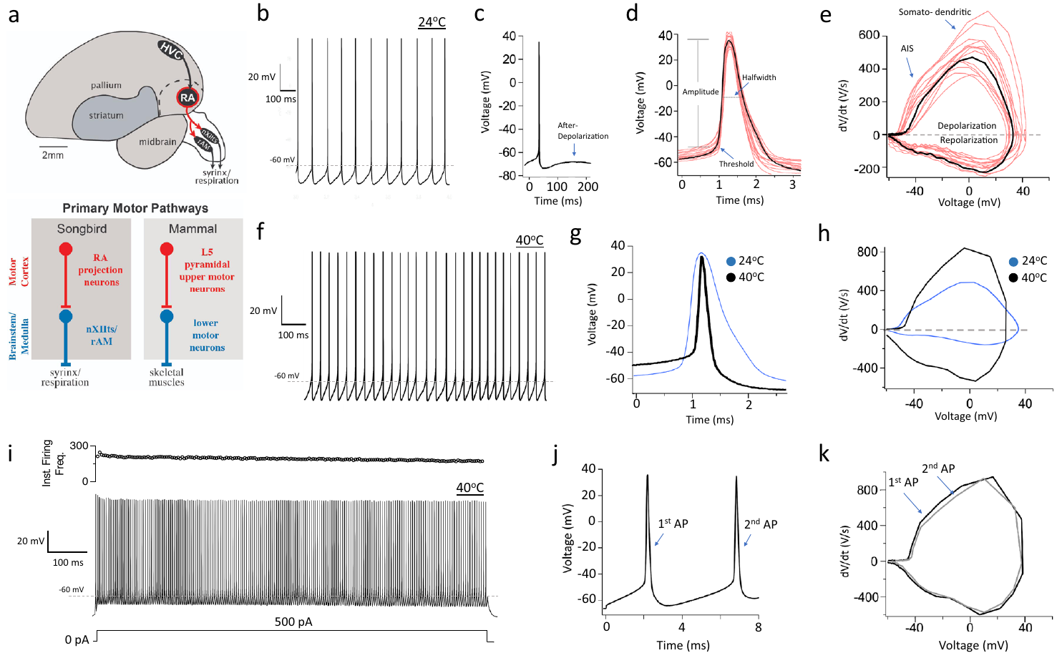
RA neurons generate exceptionally narrow spikes
An action potential is a rapid electrical spike produced by voltage-dependent membrane conductances. An ion channel is a membrane protein that permits ions to cross the membrane. Zemel and colleagues recorded identified RA projection neurons in zebra finch brain slices using whole-cell current clamp, which measures membrane voltage while current is controlled.
At approximately 40 °C, near avian physiological temperature, spontaneous spikes had a half-width of about 0.18 ms. Spontaneous firing was approximately fourfold faster than at room temperature, and depolarizing current could evoke sustained rapid spike trains.
Temperature therefore changes the quantitative description of these motor neurons. Slice recordings establish intrinsic firing capacity under controlled conditions, but are not recordings of the commands issued during a particular song syllable; intact singing additionally supplies patterned synaptic input and behavioral state.
Zemel et al. (2021), Fig. 1(a–k). RA motor anatomy and temperature-dependent spikes.
Zemel et al. (2021)
16
Notes:
• An action potential is a rapid electrical spike produced by voltage-dependent membrane conductances. An ion channel is a membrane protein that permits ions to cross the membrane. Zemel and colleagues recorded identified RA projection neurons in zebra finch brain slices using whole-cell current clamp, which measures membrane voltage while current is controlled.
• At approximately 40 °C, near avian physiological temperature, spontaneous spikes had a half-width of about 0.18 ms. Spontaneous firing was approximately fourfold faster than at room temperature, and depolarizing current could evoke sustained rapid spike trains.
• Temperature therefore changes the quantitative description of these motor neurons. Slice recordings establish intrinsic firing capacity under controlled conditions, but are not recordings of the commands issued during a particular song syllable; intact singing additionally supplies patterned synaptic input and behavioral state.
References:
Zemel BM, Nevue AA, Dagostin A, Lovell PV, Mello CV, von Gersdorff H (2021). Resurgent Na+ currents promote ultrafast spiking in projection neurons that drive fine motor control. Nature Communications 12(1):6762. https://doi.org/10.1038/s41467-021-26521-3
Figure: Zemel et al. (2021), Fig. 1(a–k). RA motor anatomy and temperature-dependent spikes.
Figure source: https://doi.org/10.1038/s41467-021-26521-3

Slide 17
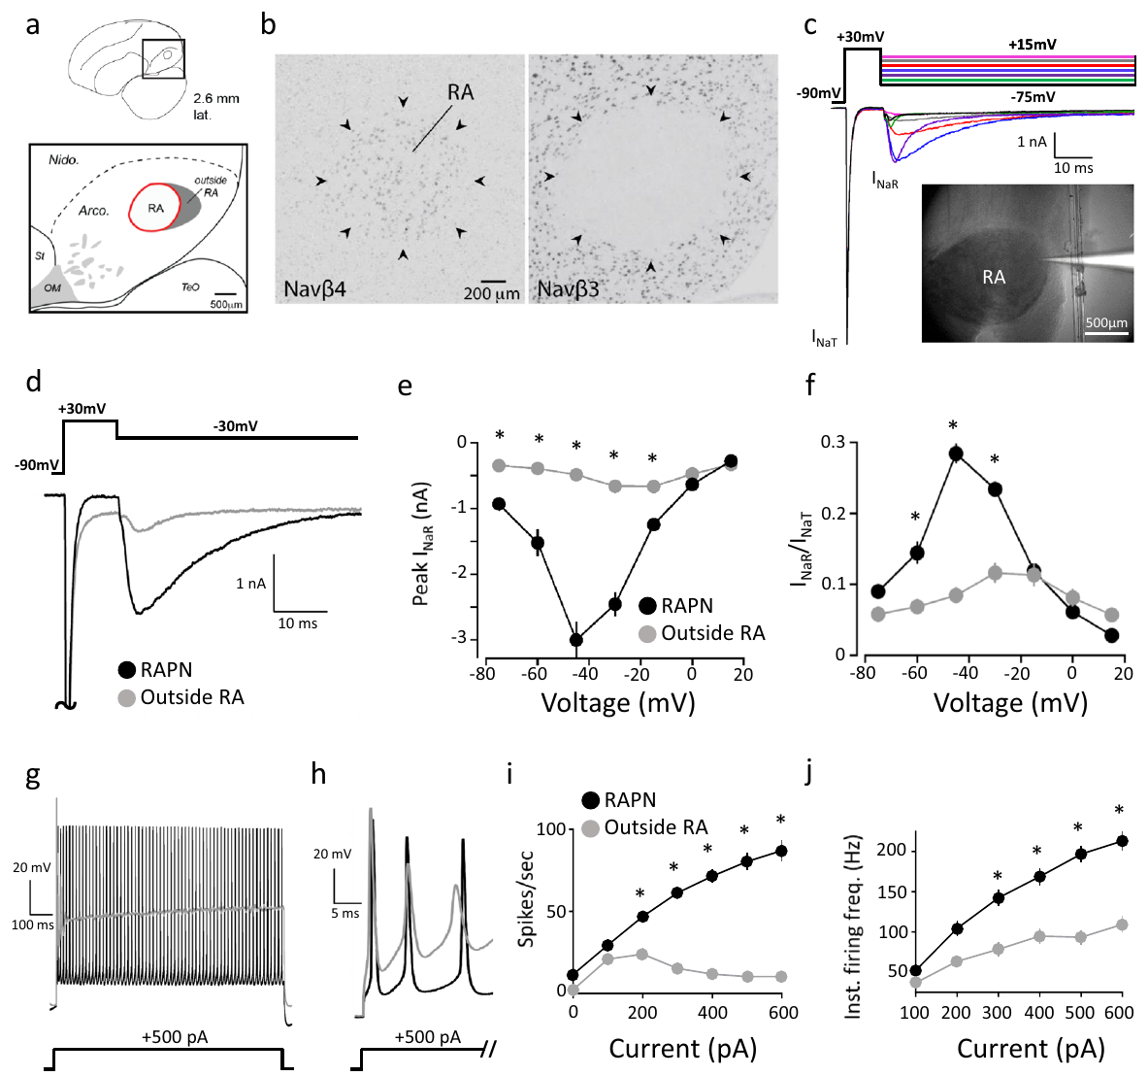
Resurgent sodium current follows repolarization
A resurgent sodium current is an inward sodium current that appears as a membrane repolarizes after strong depolarization. Zemel and colleagues used voltage clamp, which controls membrane voltage while recording current, to separate this component from the initial transient sodium current.
A step from −90 to +30 mV activated transient current; subsequent test voltages elicited resurgent current, with a peak near −3 nA at −45 mV in adult RA projection neurons. The sequence of voltage steps made the later inward current experimentally distinguishable from the initial spike-generating component.
Resurgent current can support renewed excitation during recovery from a spike. The recording establishes a membrane current under an imposed voltage protocol; its contribution to natural firing requires an additional manipulation of the conductance rather than inference from its presence alone.
Zemel et al. (2021), Fig. 2(a–j). RA sodium-subunit expression and resurgent current.
Zemel et al. (2021)
17
Notes:
• A resurgent sodium current is an inward sodium current that appears as a membrane repolarizes after strong depolarization. Zemel and colleagues used voltage clamp, which controls membrane voltage while recording current, to separate this component from the initial transient sodium current.
• A step from −90 to +30 mV activated transient current; subsequent test voltages elicited resurgent current, with a peak near −3 nA at −45 mV in adult RA projection neurons. The sequence of voltage steps made the later inward current experimentally distinguishable from the initial spike-generating component.
• Resurgent current can support renewed excitation during recovery from a spike. The recording establishes a membrane current under an imposed voltage protocol; its contribution to natural firing requires an additional manipulation of the conductance rather than inference from its presence alone.
References:
Zemel BM, Nevue AA, Dagostin A, Lovell PV, Mello CV, von Gersdorff H (2021). Resurgent Na+ currents promote ultrafast spiking in projection neurons that drive fine motor control. Nature Communications 12(1):6762. https://doi.org/10.1038/s41467-021-26521-3
Figure: Zemel et al. (2021), Fig. 2(a–j). RA sodium-subunit expression and resurgent current.
Figure source: https://doi.org/10.1038/s41467-021-26521-3

Slide 18
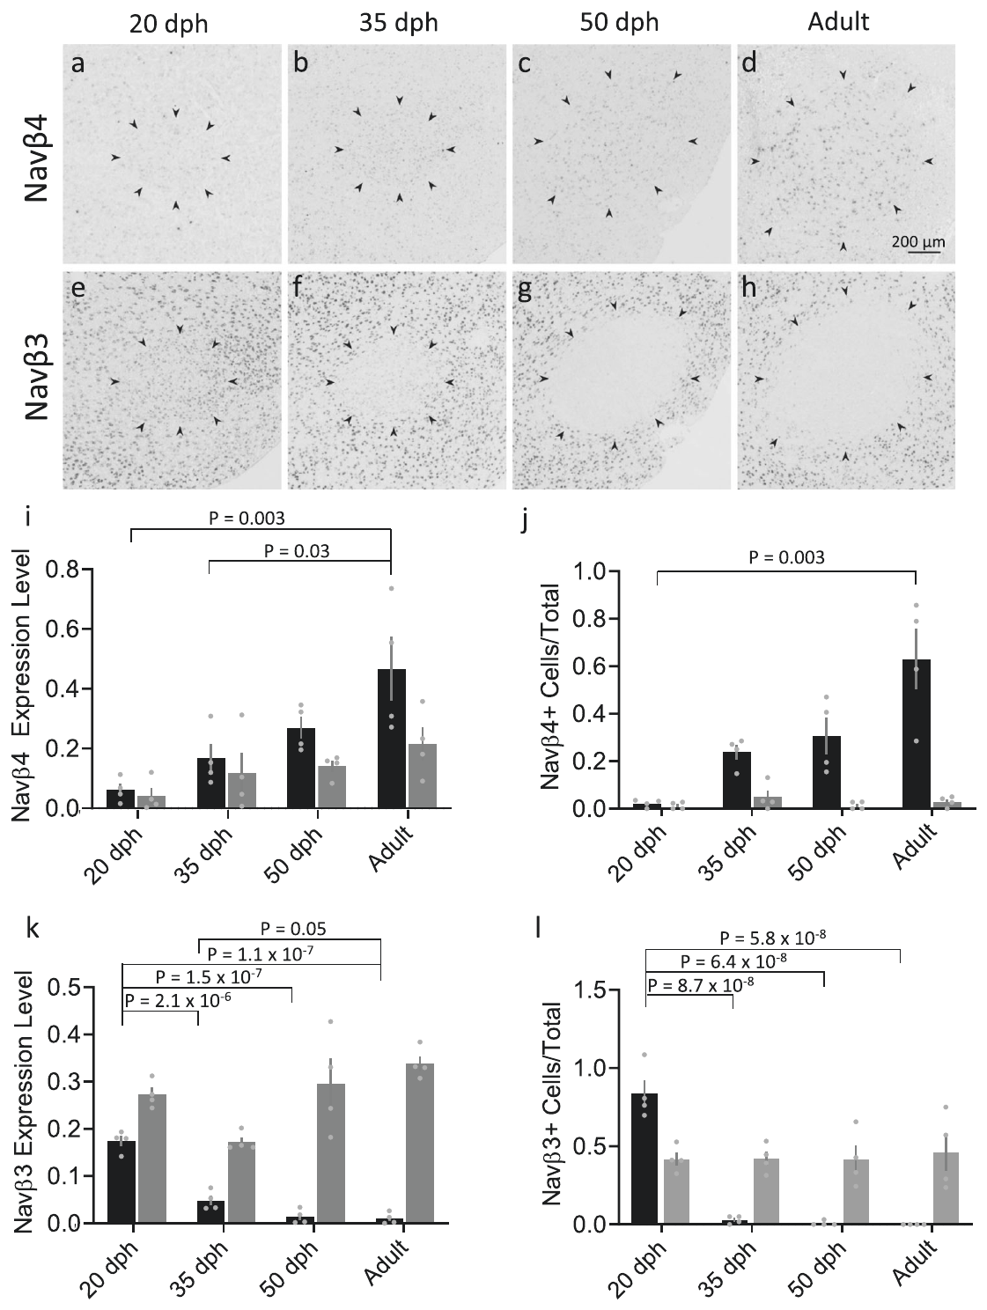
Sodium-channel subunit expression changes within RA
A sodium channel's β subunit is an accessory protein that can modify channel function. Zemel and colleagues used in situ hybridization, a method that detects specific RNA sequences in tissue, to compare Navβ3 and Navβ4 expression across male zebra finch development.
The sampled stages included 20, 35, and 50 days after hatching and adulthood. RA changed from relatively strong Navβ3 expression toward stronger Navβ4 expression; comparison with surrounding arcopallium helped distinguish an RA-related change from a uniform change throughout nearby tissue.
RNA abundance identifies a candidate molecular mechanism but does not directly measure channel current or prove that a subunit causes a behavioral transition. The expression data were therefore paired with physiological recordings and later manipulations of resurgent current.
Zemel et al. (2021), Fig. 3(a–l). Developmental sodium-subunit expression in RA.
Zemel et al. (2021)
18
Notes:
• A sodium channel's β subunit is an accessory protein that can modify channel function. Zemel and colleagues used in situ hybridization, a method that detects specific RNA sequences in tissue, to compare Navβ3 and Navβ4 expression across male zebra finch development.
• The sampled stages included 20, 35, and 50 days after hatching and adulthood. RA changed from relatively strong Navβ3 expression toward stronger Navβ4 expression; comparison with surrounding arcopallium helped distinguish an RA-related change from a uniform change throughout nearby tissue.
• RNA abundance identifies a candidate molecular mechanism but does not directly measure channel current or prove that a subunit causes a behavioral transition. The expression data were therefore paired with physiological recordings and later manipulations of resurgent current.
References:
Zemel BM, Nevue AA, Dagostin A, Lovell PV, Mello CV, von Gersdorff H (2021). Resurgent Na+ currents promote ultrafast spiking in projection neurons that drive fine motor control. Nature Communications 12(1):6762. https://doi.org/10.1038/s41467-021-26521-3
Figure: Zemel et al. (2021), Fig. 3(a–l). Developmental sodium-subunit expression in RA.
Figure source: https://doi.org/10.1038/s41467-021-26521-3

Slide 19
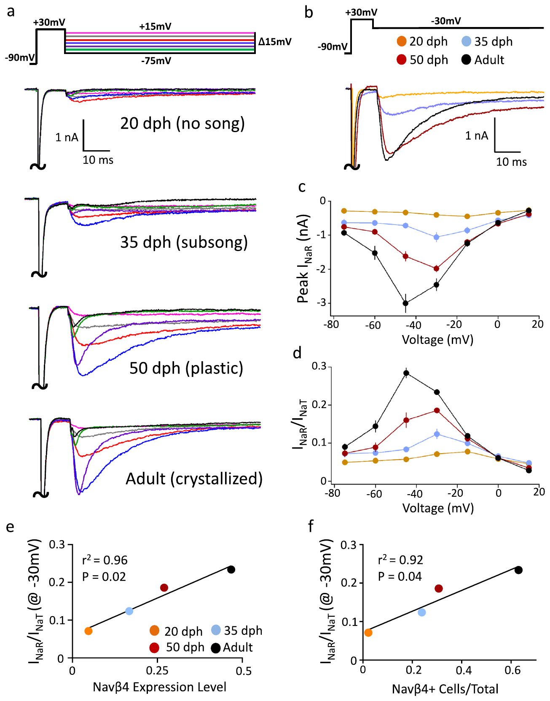
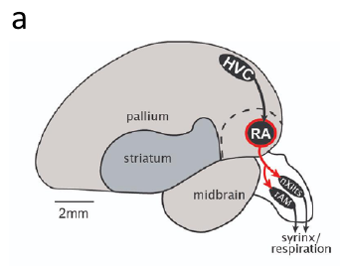
Resurgent current increases across male development
Zemel and colleagues recorded transient and resurgent sodium currents from RA projection neurons at 20, 35, and 50 days after hatching and in adult male zebra finches. Applying the same voltage protocol across stages made the current components directly comparable.
Resurgent current increased with age, including when normalized to the transient current measured within the same sweep. That normalization tested whether the developmental effect was simply an increase in all measurable sodium current rather than a disproportionate change in the resurgent component.
The age-related current increase tracked the shift toward Navβ4 expression, but a developmental correlation alone cannot identify causation. Intrinsic membrane maturation can accompany song development without being equivalent to learning a particular tutor's syllable sequence.
Zemel et al. (2021), Fig. 4(a–f). Developmental increase of resurgent current.
Zemel et al. (2021), Fig. 1(a, upper). RA and brainstem targets in the vocal motor pathway.
Zemel et al. (2021)
19
Notes:
• Zemel and colleagues recorded transient and resurgent sodium currents from RA projection neurons at 20, 35, and 50 days after hatching and in adult male zebra finches. Applying the same voltage protocol across stages made the current components directly comparable.
• Resurgent current increased with age, including when normalized to the transient current measured within the same sweep. That normalization tested whether the developmental effect was simply an increase in all measurable sodium current rather than a disproportionate change in the resurgent component.
• The age-related current increase tracked the shift toward Navβ4 expression, but a developmental correlation alone cannot identify causation. Intrinsic membrane maturation can accompany song development without being equivalent to learning a particular tutor's syllable sequence.
References:
Zemel BM, Nevue AA, Dagostin A, Lovell PV, Mello CV, von Gersdorff H (2021). Resurgent Na+ currents promote ultrafast spiking in projection neurons that drive fine motor control. Nature Communications 12(1):6762. https://doi.org/10.1038/s41467-021-26521-3
Figure: Zemel et al. (2021), Fig. 4(a–f). Developmental increase of resurgent current.
Figure source: https://doi.org/10.1038/s41467-021-26521-3
Figure: Zemel et al. (2021), Fig. 1(a, upper). RA and brainstem targets in the vocal motor pathway.
Figure source: https://doi.org/10.1038/s41467-021-26521-3

Slide 20
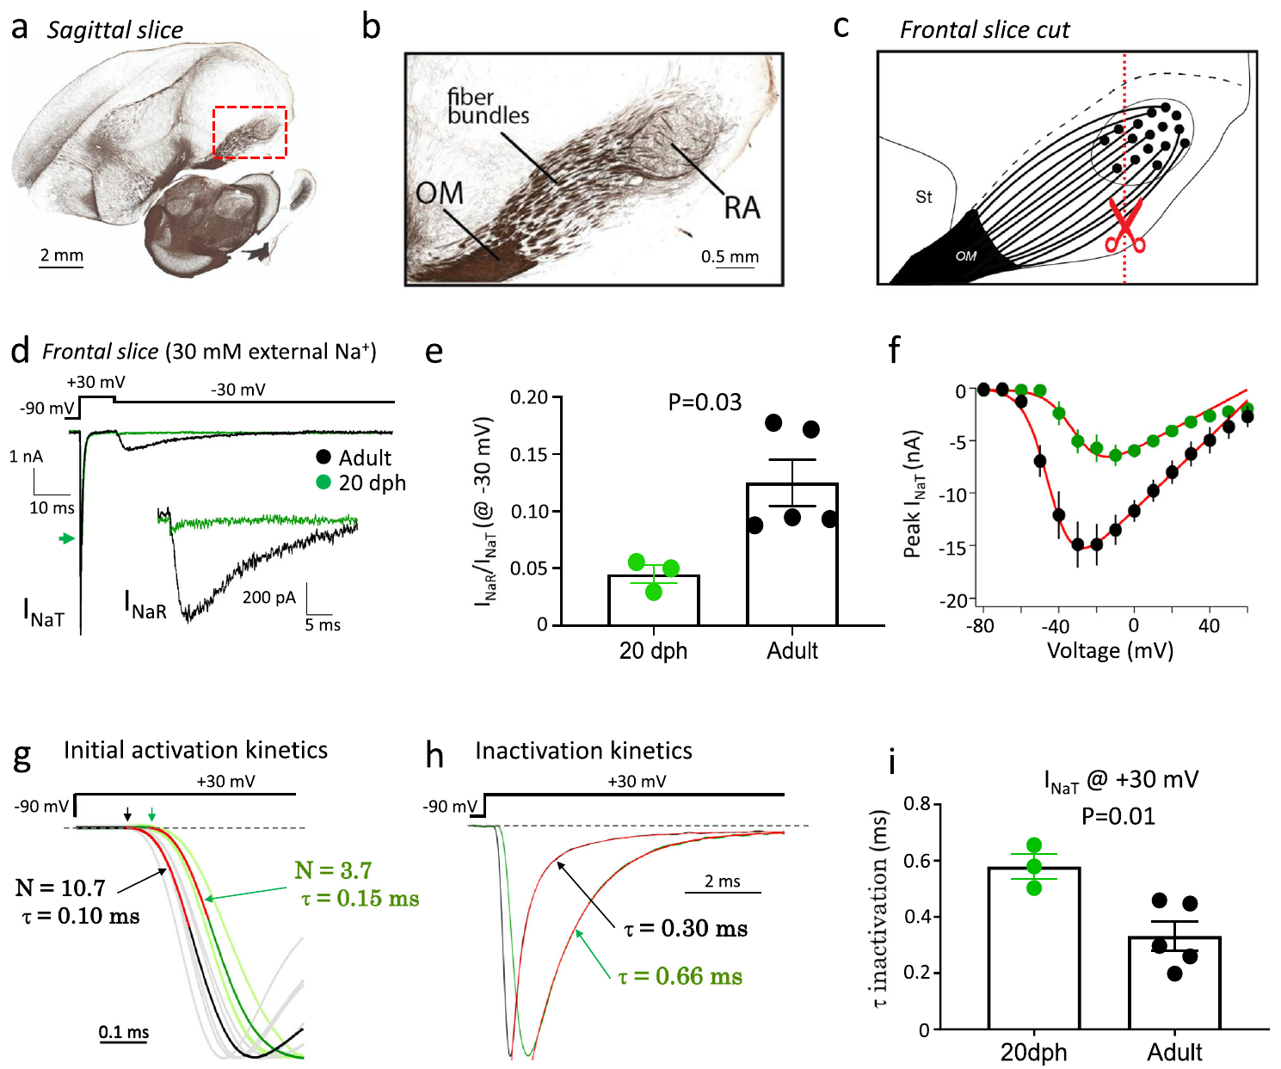
Voltage-clamp controls address axonal recording errors
Space clamp describes how well an electrode controls voltage throughout a neuron; long axons can make that control incomplete. Zemel and colleagues repeated sodium-current measurements in frontal slices that shortened the initial axonal segments of RA projection neurons.
They also reduced extracellular sodium to improve recording conditions and compared neurons from 20-day males with adult neurons. The developmental difference in resurgent current remained under these altered preparation conditions, supporting its biological origin rather than a simple difference in recording distant axons.
These controls strengthen interpretation of the current measurement without making the voltage clamp perfect. The comparison concerns isolated-cell membrane physiology, and does not itself establish how much a change in resurgent current alters the acoustic structure of a freely singing bird.
Zemel et al. (2021), Fig. 5(a–i). Axonal and voltage-clamp recording controls.
Zemel et al. (2021)
20
Notes:
• Space clamp describes how well an electrode controls voltage throughout a neuron; long axons can make that control incomplete. Zemel and colleagues repeated sodium-current measurements in frontal slices that shortened the initial axonal segments of RA projection neurons.
• They also reduced extracellular sodium to improve recording conditions and compared neurons from 20-day males with adult neurons. The developmental difference in resurgent current remained under these altered preparation conditions, supporting its biological origin rather than a simple difference in recording distant axons.
• These controls strengthen interpretation of the current measurement without making the voltage clamp perfect. The comparison concerns isolated-cell membrane physiology, and does not itself establish how much a change in resurgent current alters the acoustic structure of a freely singing bird.
References:
Zemel BM, Nevue AA, Dagostin A, Lovell PV, Mello CV, von Gersdorff H (2021). Resurgent Na+ currents promote ultrafast spiking in projection neurons that drive fine motor control. Nature Communications 12(1):6762. https://doi.org/10.1038/s41467-021-26521-3
Figure: Zemel et al. (2021), Fig. 5(a–i). Axonal and voltage-clamp recording controls.
Figure source: https://doi.org/10.1038/s41467-021-26521-3

Slide 21
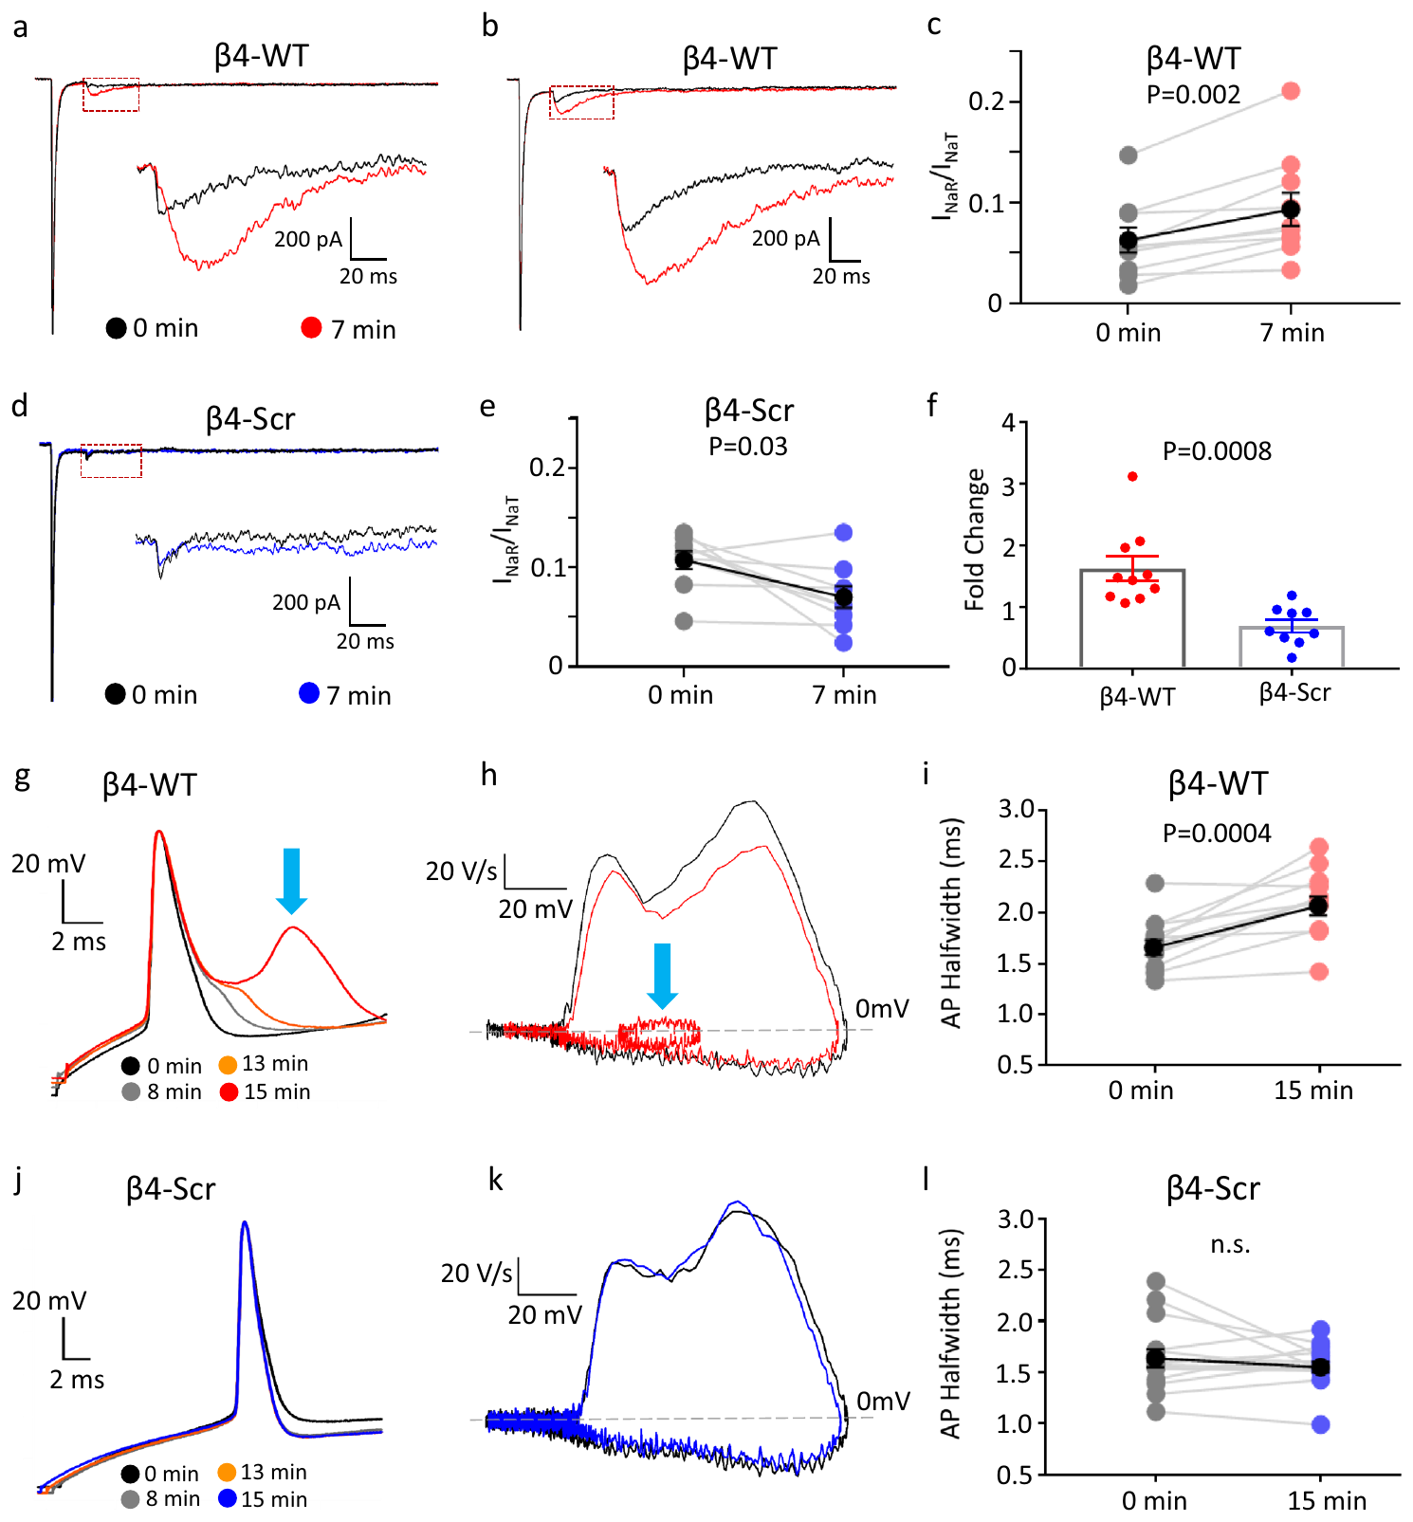
A Navβ4 peptide increases juvenile resurgent current
Zemel and colleagues introduced a peptide from the intracellular C-terminal region of Navβ4 through the recording pipette into RA neurons from 20-day male zebra finches. A peptide is a short amino-acid chain used here to test a proposed channel interaction.
Resurgent current increased over approximately 7 minutes after whole-cell access with the native peptide. A scrambled peptide containing the same amino acids in a different sequence did not produce the same increase, controlling for nonspecific introduction of peptide material.
This intervention links a defined sequence to the current phenotype more directly than RNA expression alone. It does not recreate every function of the intact β4 protein or establish that this peptide manipulation improves song learning in a behaving bird.
Zemel et al. (2021), Fig. 7(a–l). Native and scrambled Navβ4 peptide interventions.
Zemel et al. (2021), Fig. 1(a, upper). RA and brainstem targets in the vocal motor pathway.
Zemel et al. (2021)
21
Notes:
• Zemel and colleagues introduced a peptide from the intracellular C-terminal region of Navβ4 through the recording pipette into RA neurons from 20-day male zebra finches. A peptide is a short amino-acid chain used here to test a proposed channel interaction.
• Resurgent current increased over approximately 7 minutes after whole-cell access with the native peptide. A scrambled peptide containing the same amino acids in a different sequence did not produce the same increase, controlling for nonspecific introduction of peptide material.
• This intervention links a defined sequence to the current phenotype more directly than RNA expression alone. It does not recreate every function of the intact β4 protein or establish that this peptide manipulation improves song learning in a behaving bird.
References:
Zemel BM, Nevue AA, Dagostin A, Lovell PV, Mello CV, von Gersdorff H (2021). Resurgent Na+ currents promote ultrafast spiking in projection neurons that drive fine motor control. Nature Communications 12(1):6762. https://doi.org/10.1038/s41467-021-26521-3
Figure: Zemel et al. (2021), Fig. 7(a–l). Native and scrambled Navβ4 peptide interventions.
Figure source: https://doi.org/10.1038/s41467-021-26521-3
Figure: Zemel et al. (2021), Fig. 1(a, upper). RA and brainstem targets in the vocal motor pathway.
Figure source: https://doi.org/10.1038/s41467-021-26521-3

Slide 22
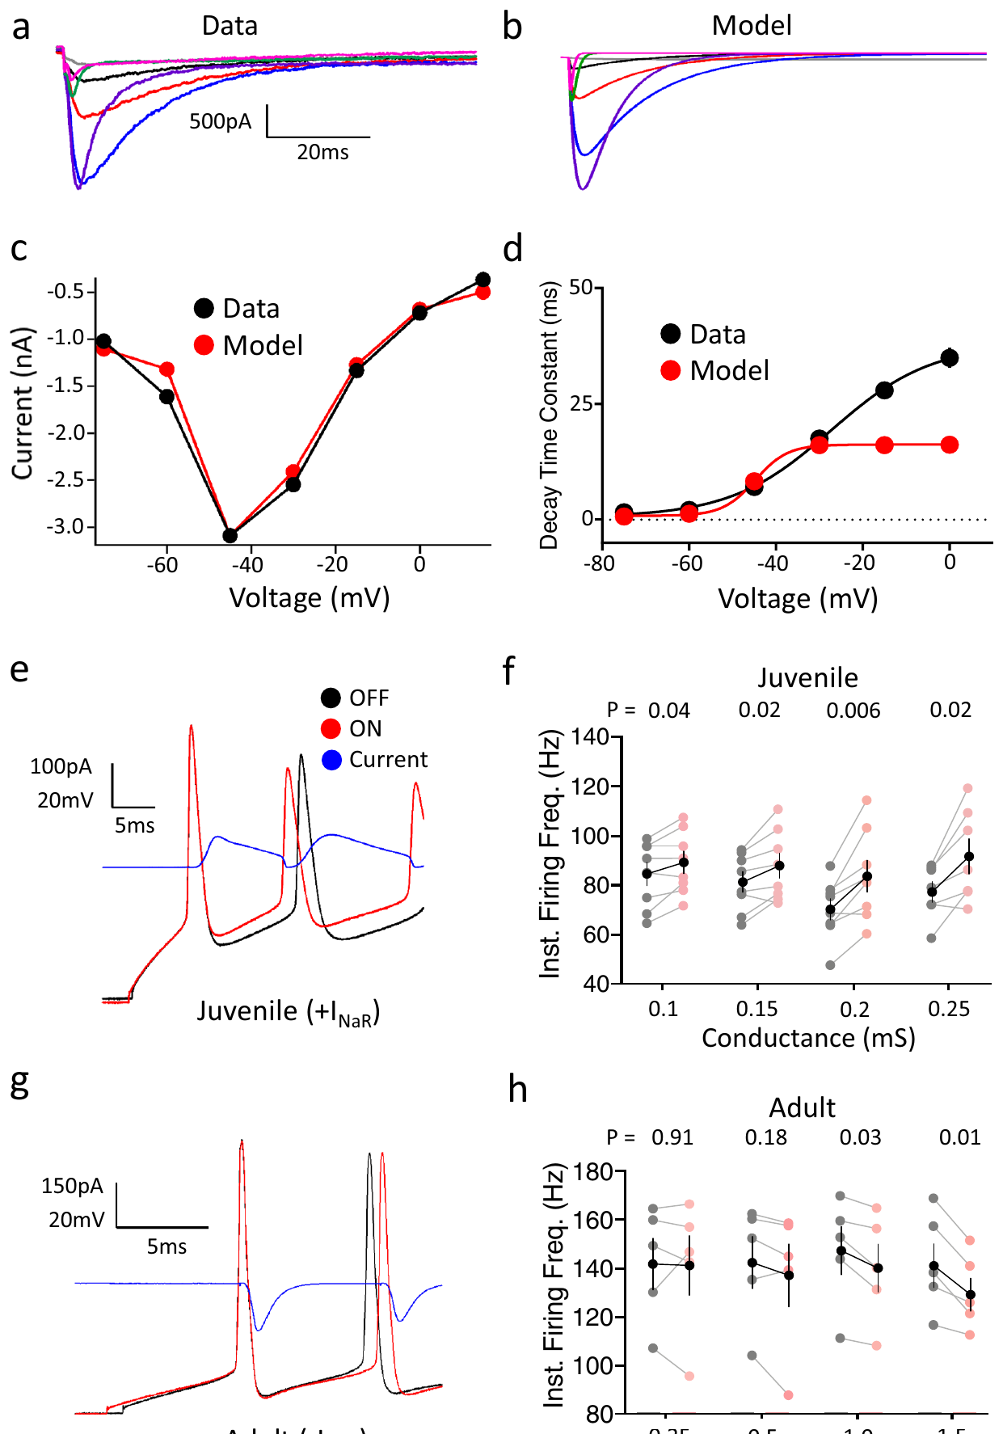
Dynamic clamp tests the effect of resurgent current
Dynamic clamp computes a voltage-dependent current during recording and injects that current into a real neuron. Zemel and colleagues used this method to add a resurgent-current component to juvenile RA neurons and subtract a corresponding component from adult neurons.
Adding the component increased juvenile firing frequency, whereas subtraction reduced adult firing. The same cell could be compared with the intervention off and on, separating the immediate current effect from stable differences between developmental populations.
The experiment supports a causal contribution of resurgent current to neuronal excitability. The injected conductance was calibrated to measured sodium-current kinetics. Agreement with voltage-clamp recordings does not establish that this conductance alone explains song timing or behavioral proficiency.
Zemel et al. (2021), Fig. 8(a–h). Current records and dynamic-clamp interventions.
Zemel et al. (2021), Fig. 1(a, upper). RA and brainstem targets in the vocal motor pathway.
Zemel et al. (2021)
22
Notes:
• Dynamic clamp computes a voltage-dependent current during recording and injects that current into a real neuron. Zemel and colleagues used this method to add a resurgent-current component to juvenile RA neurons and subtract a corresponding component from adult neurons.
• Adding the component increased juvenile firing frequency, whereas subtraction reduced adult firing. The same cell could be compared with the intervention off and on, separating the immediate current effect from stable differences between developmental populations.
• The experiment supports a causal contribution of resurgent current to neuronal excitability. The injected conductance was calibrated to measured sodium-current kinetics. Agreement with voltage-clamp recordings does not establish that this conductance alone explains song timing or behavioral proficiency.
References:
Zemel BM, Nevue AA, Dagostin A, Lovell PV, Mello CV, von Gersdorff H (2021). Resurgent Na+ currents promote ultrafast spiking in projection neurons that drive fine motor control. Nature Communications 12(1):6762. https://doi.org/10.1038/s41467-021-26521-3
Figure: Zemel et al. (2021), Fig. 8(a–h). Current records and dynamic-clamp interventions.
Figure source: https://doi.org/10.1038/s41467-021-26521-3
Figure: Zemel et al. (2021), Fig. 1(a, upper). RA and brainstem targets in the vocal motor pathway.
Figure source: https://doi.org/10.1038/s41467-021-26521-3

Slide 23
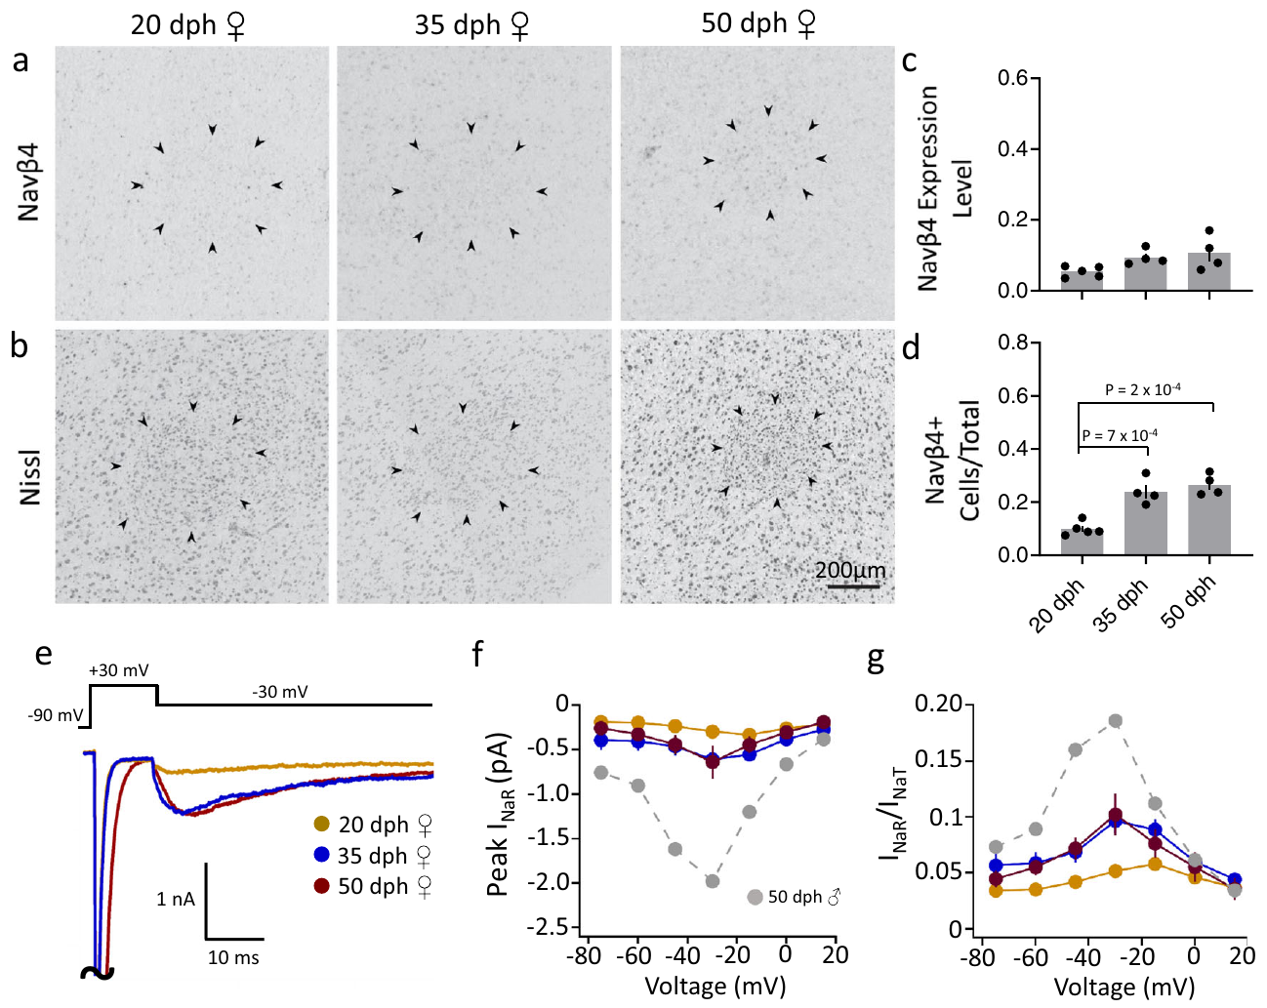
RA maturation differs between males and females
Zemel and colleagues compared Navβ4 expression and RA physiology across ages in female zebra finches, which do not produce the learned courtship song characteristic of males. In situ hybridization was assessed alongside adjacent Nissl-stained sections identifying the nucleus.
Females did not exhibit the male pattern of strong developmental Navβ4 upregulation and mature resurgent-current specialization. This comparison separated a sex-related developmental program from a change that would necessarily occur in every zebra finch reaching the same chronological age.
Male birds isolated from tutor song nevertheless developed mature firing properties, further separating intrinsic maturation from successful imitation. The results support sex-linked motor-system specialization; they do not establish that a single sodium-channel subunit is sufficient to create singing behavior.
Zemel et al. (2021), Fig. 9(a–g). Female RA expression and sodium-current measurements.
Zemel et al. (2021)
23
Notes:
• Zemel and colleagues compared Navβ4 expression and RA physiology across ages in female zebra finches, which do not produce the learned courtship song characteristic of males. In situ hybridization was assessed alongside adjacent Nissl-stained sections identifying the nucleus.
• Females did not exhibit the male pattern of strong developmental Navβ4 upregulation and mature resurgent-current specialization. This comparison separated a sex-related developmental program from a change that would necessarily occur in every zebra finch reaching the same chronological age.
• Male birds isolated from tutor song nevertheless developed mature firing properties, further separating intrinsic maturation from successful imitation. The results support sex-linked motor-system specialization; they do not establish that a single sodium-channel subunit is sufficient to create singing behavior.
References:
Zemel BM, Nevue AA, Dagostin A, Lovell PV, Mello CV, von Gersdorff H (2021). Resurgent Na+ currents promote ultrafast spiking in projection neurons that drive fine motor control. Nature Communications 12(1):6762. https://doi.org/10.1038/s41467-021-26521-3
Figure: Zemel et al. (2021), Fig. 9(a–g). Female RA expression and sodium-current measurements.
Figure source: https://doi.org/10.1038/s41467-021-26521-3

Slide 24
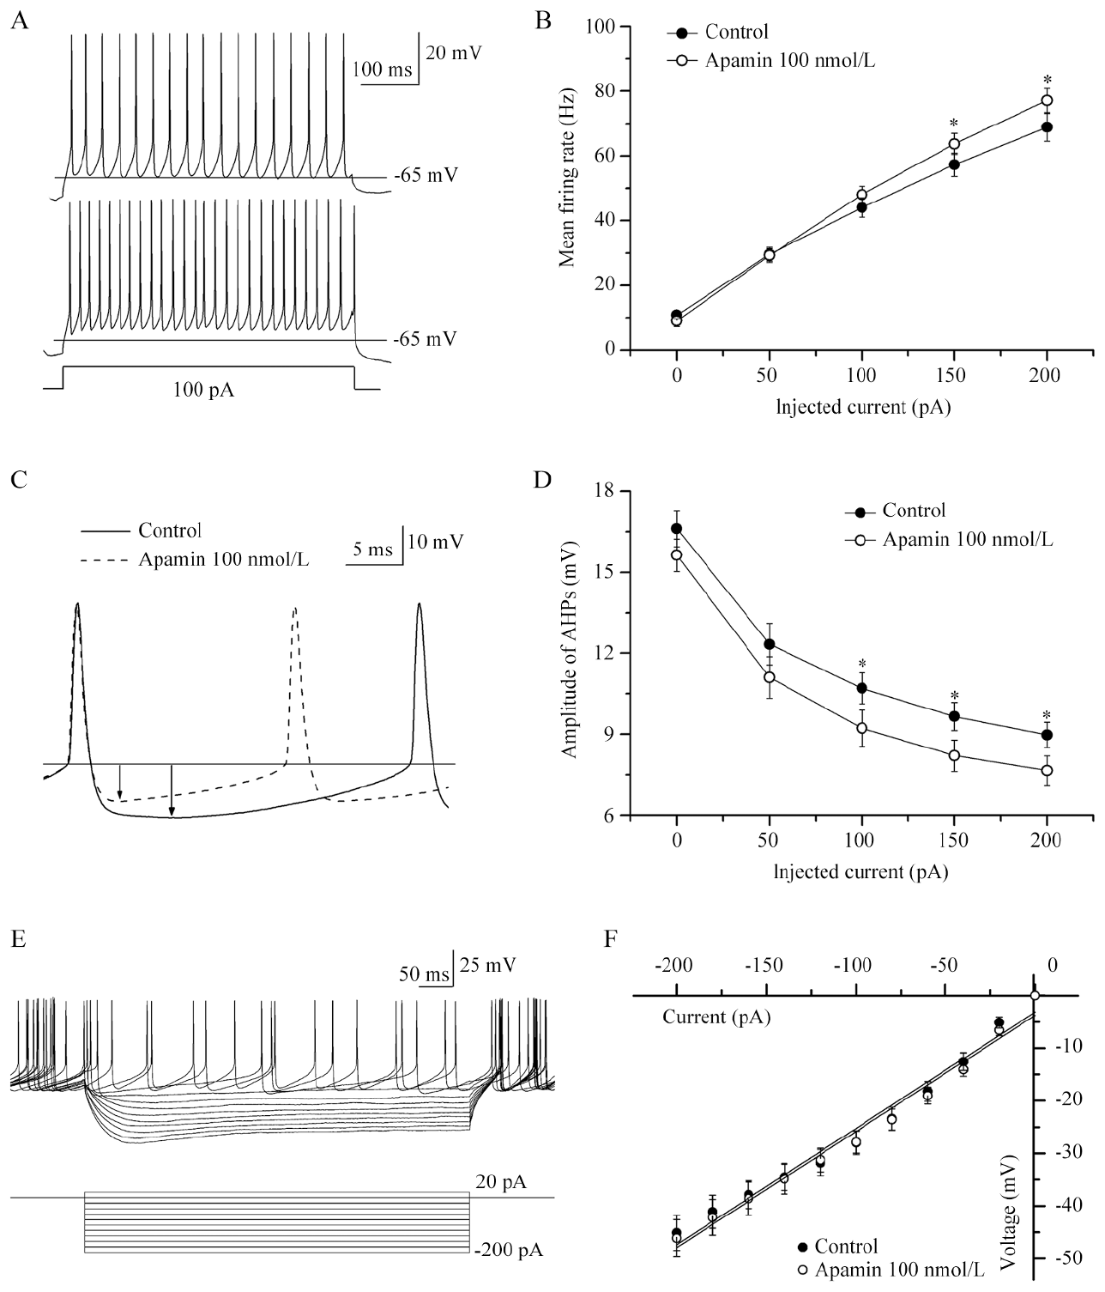
SK channels contribute to the afterhyperpolarization
SK channels are small-conductance calcium-activated potassium channels. Calcium-dependent potassium efflux can produce an afterhyperpolarization, a period of more negative membrane voltage following a spike that regulates when the next spike occurs.
Hou and colleagues recorded RA projection neurons in adult male zebra finch slices and applied apamin, an SK-channel blocker, at 100 nM. An example response to 100 pA rose from 34 to about 53 Hz. Blocking the channels reduced the afterhyperpolarization and increased current-evoked firing, linking the pharmacological target to both the spike waveform and ongoing excitability.
The direction of the effect is consistent with removal of a potassium-mediated brake on excitation. Pharmacology establishes a contribution under the slice conditions, but does not identify every SK subunit or prove how this manipulation would change the timing of a complete song.
Hou et al. (2012), Fig. 1(A–F). SK blockade changes evoked firing and spike recovery.
Zemel et al. (2021), Fig. 1(a, upper). RA and brainstem targets in the vocal motor pathway.
Hou et al. (2012); Zemel et al. (2021)
24
Notes:
• SK channels are small-conductance calcium-activated potassium channels. Calcium-dependent potassium efflux can produce an afterhyperpolarization, a period of more negative membrane voltage following a spike that regulates when the next spike occurs.
• Hou and colleagues recorded RA projection neurons in adult male zebra finch slices and applied apamin, an SK-channel blocker, at 100 nM. An example response to 100 pA rose from 34 to about 53 Hz. Blocking the channels reduced the afterhyperpolarization and increased current-evoked firing, linking the pharmacological target to both the spike waveform and ongoing excitability.
• The direction of the effect is consistent with removal of a potassium-mediated brake on excitation. Pharmacology establishes a contribution under the slice conditions, but does not identify every SK subunit or prove how this manipulation would change the timing of a complete song.
References:
Hou GQ, Pan X, Liao CS, Wang SH, Li DF (2012). SK channels modulate the excitability and firing precision of projection neurons in the robust nucleus of the arcopallium in adult male zebra finches. Neuroscience Bulletin 28(3):271-281. https://doi.org/10.1007/s12264-012-1241-7
Zemel BM, Nevue AA, Dagostin A, Lovell PV, Mello CV, von Gersdorff H (2021). Resurgent Na+ currents promote ultrafast spiking in projection neurons that drive fine motor control. Nature Communications 12(1):6762. https://doi.org/10.1038/s41467-021-26521-3
Figure: Hou et al. (2012), Fig. 1(A–F). SK blockade changes evoked firing and spike recovery.
Figure source: https://doi.org/10.1007/s12264-012-1241-7
Figure: Zemel et al. (2021), Fig. 1(a, upper). RA and brainstem targets in the vocal motor pathway.
Figure source: https://doi.org/10.1038/s41467-021-26521-3

Slide 25
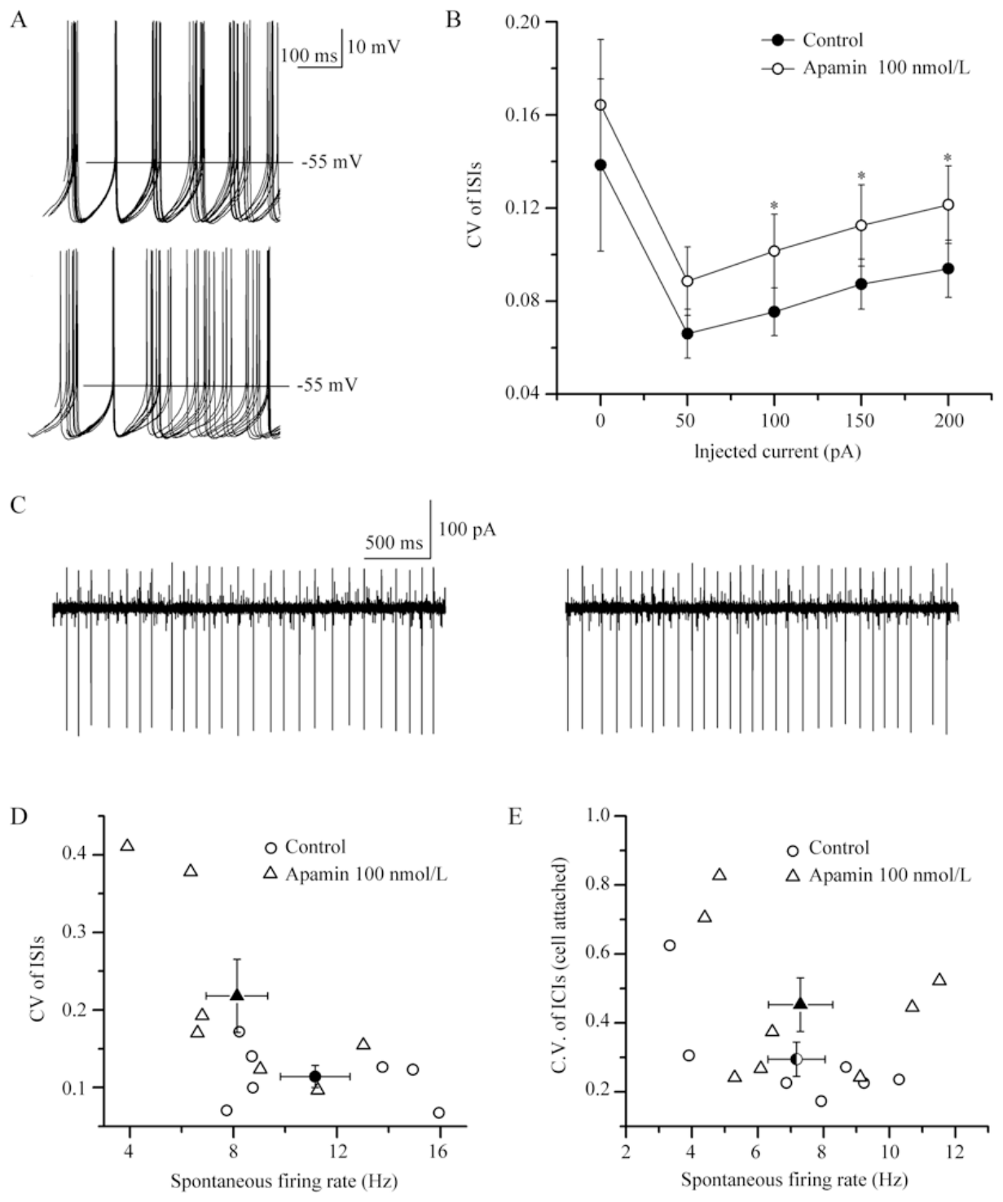
SK blockade makes RA firing less regular
Interspike intervals are the times separating successive action potentials. Hou and colleagues compared spontaneous spike trains from the same RA projection neurons before and after apamin, allowing firing regularity to be assessed separately from the mean firing rate.
SK blockade increased variability in the intervals between spikes without a clear change in average spontaneous firing rate. Recordings therefore distinguished a neuron that fires more rapidly from a neuron that fires with more reproducible timing; these are different physiological properties.
Calcium-activated potassium feedback can stabilize the return toward spike threshold after each action potential. The result supports a contribution to temporal regularity in isolated RA cells, but natural song-related precision also depends on the timing of HVC and LMAN inputs and cannot be assigned entirely to SK channels.
Hou et al. (2012), Fig. 2(A–E). Spontaneous spike timing before and after apamin.
Zemel et al. (2021), Fig. 1(a, upper). RA and brainstem targets in the vocal motor pathway.
Hou et al. (2012); Zemel et al. (2021)
25
Notes:
• Interspike intervals are the times separating successive action potentials. Hou and colleagues compared spontaneous spike trains from the same RA projection neurons before and after apamin, allowing firing regularity to be assessed separately from the mean firing rate.
• SK blockade increased variability in the intervals between spikes without a clear change in average spontaneous firing rate. Recordings therefore distinguished a neuron that fires more rapidly from a neuron that fires with more reproducible timing; these are different physiological properties.
• Calcium-activated potassium feedback can stabilize the return toward spike threshold after each action potential. The result supports a contribution to temporal regularity in isolated RA cells, but natural song-related precision also depends on the timing of HVC and LMAN inputs and cannot be assigned entirely to SK channels.
References:
Hou GQ, Pan X, Liao CS, Wang SH, Li DF (2012). SK channels modulate the excitability and firing precision of projection neurons in the robust nucleus of the arcopallium in adult male zebra finches. Neuroscience Bulletin 28(3):271-281. https://doi.org/10.1007/s12264-012-1241-7
Zemel BM, Nevue AA, Dagostin A, Lovell PV, Mello CV, von Gersdorff H (2021). Resurgent Na+ currents promote ultrafast spiking in projection neurons that drive fine motor control. Nature Communications 12(1):6762. https://doi.org/10.1038/s41467-021-26521-3
Figure: Hou et al. (2012), Fig. 2(A–E). Spontaneous spike timing before and after apamin.
Figure source: https://doi.org/10.1007/s12264-012-1241-7
Figure: Zemel et al. (2021), Fig. 1(a, upper). RA and brainstem targets in the vocal motor pathway.
Figure source: https://doi.org/10.1038/s41467-021-26521-3

Slide 26
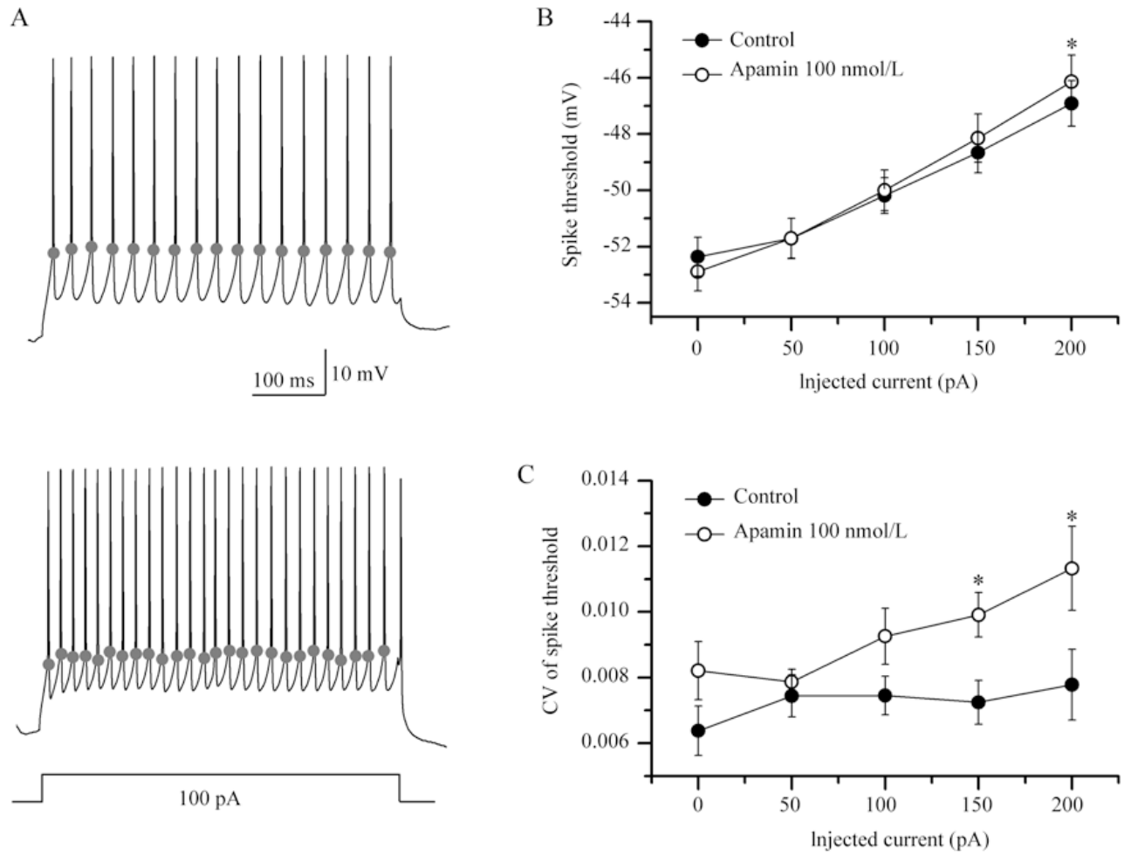
SK blockade destabilizes evoked spike threshold
A spike threshold is the membrane voltage at which regenerative excitation initiates an action potential. Hou and colleagues evoked firing with a 100 pA depolarizing current and compared threshold measurements before and after 100 nM apamin blocked SK channels.
Blockade increased the variation of evoked spike thresholds and shifted them toward more depolarized voltages as injected current increased. The recordings linked irregular firing with less stable spike initiation rather than assuming that every change in spike count reflected the same membrane mechanism.
The measured effect supports a role for calcium-activated potassium feedback in recovery between spikes. It does not identify the complete sequence of sodium-channel recovery or the calcium source activating SK channels, and spontaneous and current-evoked firing need not respond identically to the same intervention.
Hou et al. (2012), Fig. 3(A–C). Evoked threshold changes during SK blockade.
Zemel et al. (2021), Fig. 1(a, upper). RA and brainstem targets in the vocal motor pathway.
Hou et al. (2012); Zemel et al. (2021)
26
Notes:
• A spike threshold is the membrane voltage at which regenerative excitation initiates an action potential. Hou and colleagues evoked firing with a 100 pA depolarizing current and compared threshold measurements before and after 100 nM apamin blocked SK channels.
• Blockade increased the variation of evoked spike thresholds and shifted them toward more depolarized voltages as injected current increased. The recordings linked irregular firing with less stable spike initiation rather than assuming that every change in spike count reflected the same membrane mechanism.
• The measured effect supports a role for calcium-activated potassium feedback in recovery between spikes. It does not identify the complete sequence of sodium-channel recovery or the calcium source activating SK channels, and spontaneous and current-evoked firing need not respond identically to the same intervention.
References:
Hou GQ, Pan X, Liao CS, Wang SH, Li DF (2012). SK channels modulate the excitability and firing precision of projection neurons in the robust nucleus of the arcopallium in adult male zebra finches. Neuroscience Bulletin 28(3):271-281. https://doi.org/10.1007/s12264-012-1241-7
Zemel BM, Nevue AA, Dagostin A, Lovell PV, Mello CV, von Gersdorff H (2021). Resurgent Na+ currents promote ultrafast spiking in projection neurons that drive fine motor control. Nature Communications 12(1):6762. https://doi.org/10.1038/s41467-021-26521-3
Figure: Hou et al. (2012), Fig. 3(A–C). Evoked threshold changes during SK blockade.
Figure source: https://doi.org/10.1007/s12264-012-1241-7
Figure: Zemel et al. (2021), Fig. 1(a, upper). RA and brainstem targets in the vocal motor pathway.
Figure source: https://doi.org/10.1038/s41467-021-26521-3

Slide 27
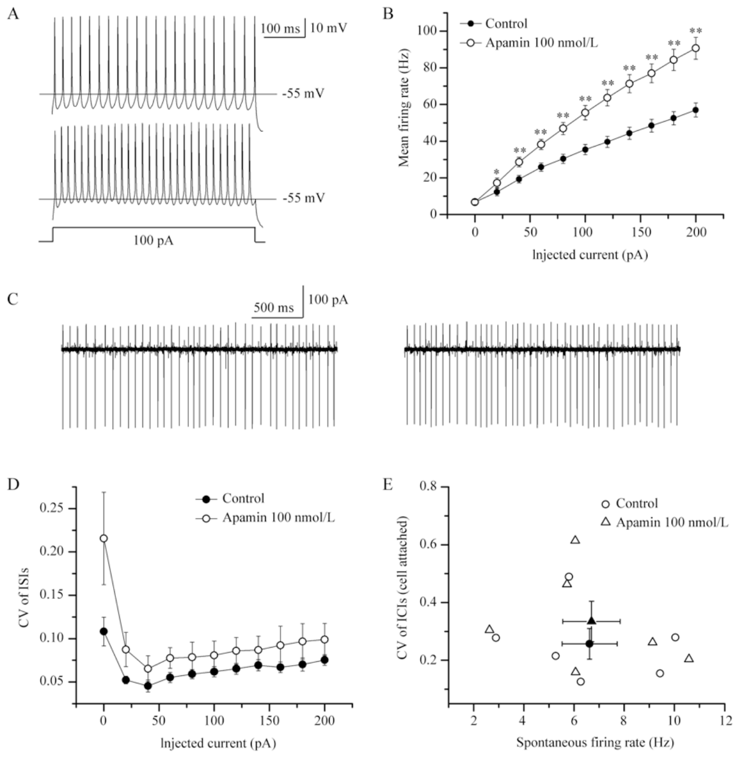
Synaptic input contributes to the SK regularity effect
Hou and colleagues blocked ionotropic glutamate receptors while recording RA projection neurons. AMPA receptors support relatively fast excitatory transmission, whereas NMDA receptors have slower kinetics and voltage-dependent gating; the antagonists DNQX and APV suppress these receptor components.
Apamin still increased current-evoked firing after receptor blockade, but its effect on firing regularity was no longer clearly detectable. This comparison separated an excitability effect that persisted without glutamatergic input from a regularity effect that depended on the recording's synaptic conditions.
Intrinsic potassium conductance and incoming excitation therefore interact in determining spike timing. The control does not identify the presynaptic source responsible for the difference or establish the corresponding effect during singing; it constrains a purely intrinsic explanation of all changes in temporal regularity.
Hou et al. (2012), Fig. 4(A–E). Apamin effects after glutamate-receptor blockade.
Zemel et al. (2021), Fig. 1(a, upper). RA and brainstem targets in the vocal motor pathway.
Hou et al. (2012); Zemel et al. (2021)
27
Notes:
• Hou and colleagues blocked ionotropic glutamate receptors while recording RA projection neurons. AMPA receptors support relatively fast excitatory transmission, whereas NMDA receptors have slower kinetics and voltage-dependent gating; the antagonists DNQX and APV suppress these receptor components.
• Apamin still increased current-evoked firing after receptor blockade, but its effect on firing regularity was no longer clearly detectable. This comparison separated an excitability effect that persisted without glutamatergic input from a regularity effect that depended on the recording's synaptic conditions.
• Intrinsic potassium conductance and incoming excitation therefore interact in determining spike timing. The control does not identify the presynaptic source responsible for the difference or establish the corresponding effect during singing; it constrains a purely intrinsic explanation of all changes in temporal regularity.
References:
Hou GQ, Pan X, Liao CS, Wang SH, Li DF (2012). SK channels modulate the excitability and firing precision of projection neurons in the robust nucleus of the arcopallium in adult male zebra finches. Neuroscience Bulletin 28(3):271-281. https://doi.org/10.1007/s12264-012-1241-7
Zemel BM, Nevue AA, Dagostin A, Lovell PV, Mello CV, von Gersdorff H (2021). Resurgent Na+ currents promote ultrafast spiking in projection neurons that drive fine motor control. Nature Communications 12(1):6762. https://doi.org/10.1038/s41467-021-26521-3
Figure: Hou et al. (2012), Fig. 4(A–E). Apamin effects after glutamate-receptor blockade.
Figure source: https://doi.org/10.1007/s12264-012-1241-7
Figure: Zemel et al. (2021), Fig. 1(a, upper). RA and brainstem targets in the vocal motor pathway.
Figure source: https://doi.org/10.1038/s41467-021-26521-3

Slide 28
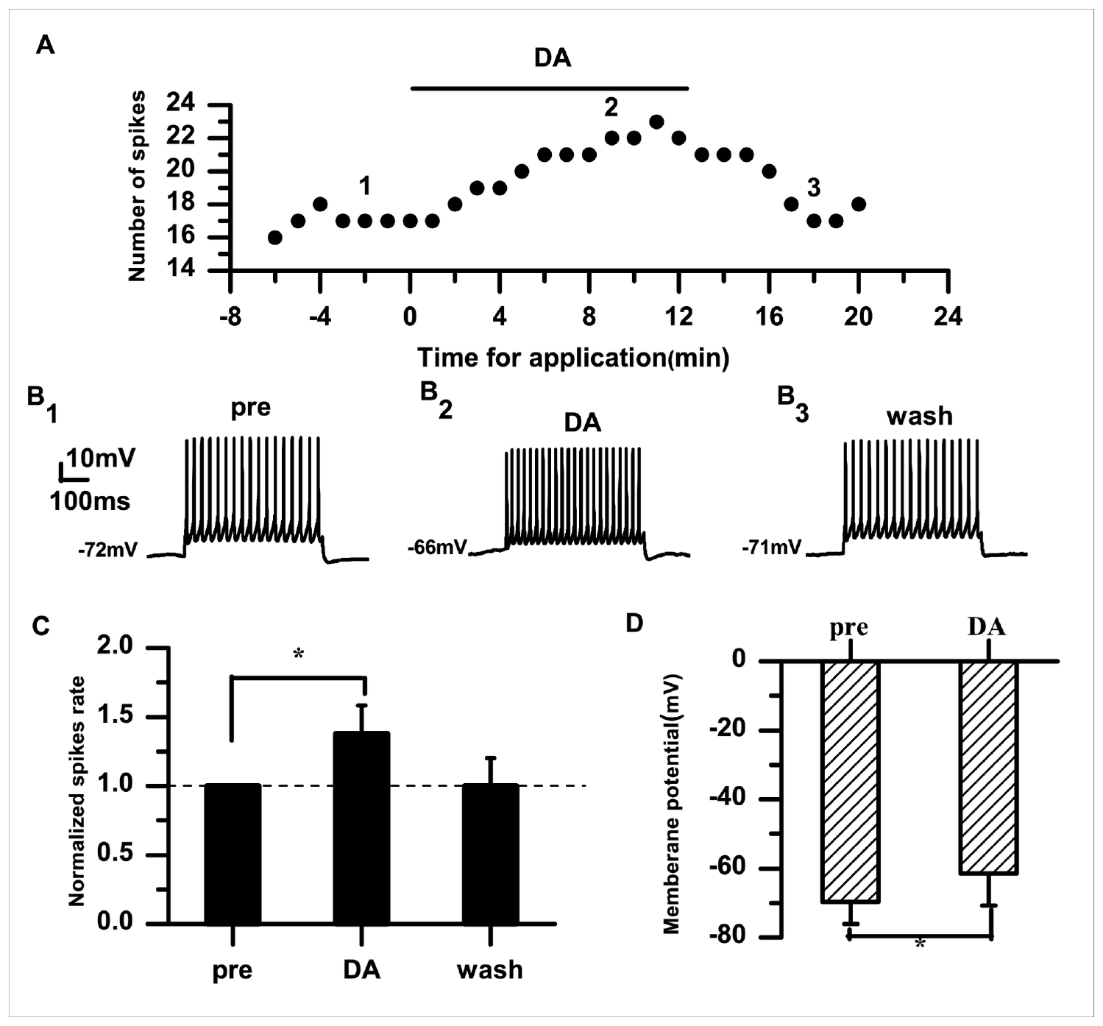
Dopamine increases RA neuronal excitability
Dopamine is a neurotransmitter that can modulate neuronal properties through receptor-dependent intracellular signaling. Liao and colleagues recorded adult male zebra finch RA projection neurons and applied 50 µM dopamine while controlling the injected current.
During a 100 pA stimulus, normalized firing increased to approximately 1.38 times baseline and returned toward baseline after washout. The membrane potential became less negative, shifting from approximately −70 to −61 mV under the reported recording conditions.
The within-cell drug and wash comparisons establish reversible modulation of excitability rather than a difference between cell populations. Bath application does not reproduce the concentration, duration, or spatial precision of physiological dopamine release, so these measurements should not be equated directly with a behavioral state during singing.
Liao et al. (2013), Fig. 1(A–D). Reversible dopamine effects on RA firing and voltage.
Zemel et al. (2021), Fig. 1(a, upper). RA and brainstem targets in the vocal motor pathway.
Liao et al. (2013); Zemel et al. (2021)
28
Notes:
• Dopamine is a neurotransmitter that can modulate neuronal properties through receptor-dependent intracellular signaling. Liao and colleagues recorded adult male zebra finch RA projection neurons and applied 50 µM dopamine while controlling the injected current.
• During a 100 pA stimulus, normalized firing increased to approximately 1.38 times baseline and returned toward baseline after washout. The membrane potential became less negative, shifting from approximately −70 to −61 mV under the reported recording conditions.
• The within-cell drug and wash comparisons establish reversible modulation of excitability rather than a difference between cell populations. Bath application does not reproduce the concentration, duration, or spatial precision of physiological dopamine release, so these measurements should not be equated directly with a behavioral state during singing.
References:
Liao C, Wang S, Pan X, Hou G, Li D (2013). Dopamine Modulates the Excitability of Projection Neurons in the Robust Nucleus of the Arcopallium in Adult Zebra Finches. PLoS ONE 8(12):e82497. https://doi.org/10.1371/journal.pone.0082497
Zemel BM, Nevue AA, Dagostin A, Lovell PV, Mello CV, von Gersdorff H (2021). Resurgent Na+ currents promote ultrafast spiking in projection neurons that drive fine motor control. Nature Communications 12(1):6762. https://doi.org/10.1038/s41467-021-26521-3
Figure: Liao et al. (2013), Fig. 1(A–D). Reversible dopamine effects on RA firing and voltage.
Figure source: https://doi.org/10.1371/journal.pone.0082497
Figure: Zemel et al. (2021), Fig. 1(a, upper). RA and brainstem targets in the vocal motor pathway.
Figure source: https://doi.org/10.1038/s41467-021-26521-3

Slide 29
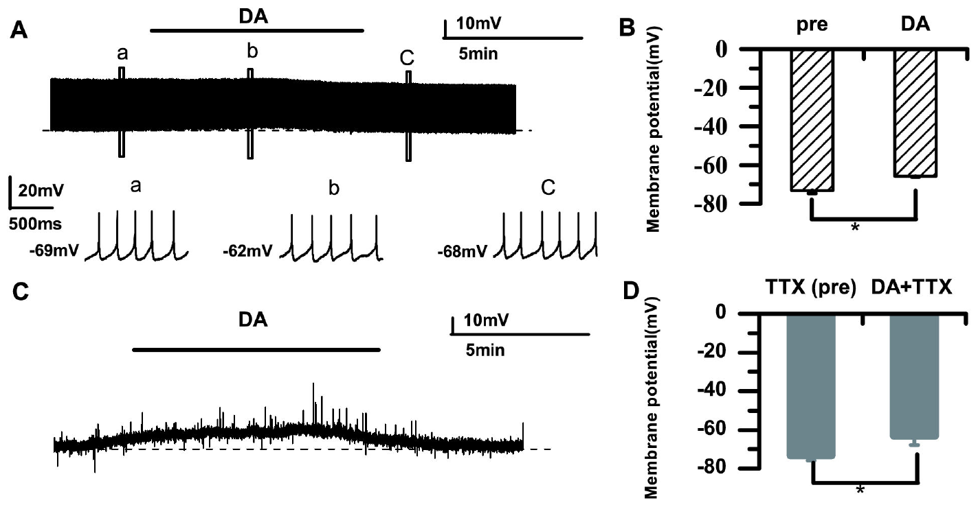
Dopamine depolarization persists without spikes
Liao and colleagues used tetrodotoxin, or TTX, to block voltage-gated sodium channels and prevent action potentials in their RA slice preparation. This manipulation tested whether dopamine-induced depolarization depended on spike-driven activity in the surrounding network.
Dopamine still produced a depolarizing membrane shift when sodium-dependent spikes were suppressed. The result separated the change in resting membrane behavior from the increased number of evoked action potentials observed in the unblocked preparation.
A direct or locally mediated membrane effect is therefore supported, but the specific ionic conductance responsible was not isolated by this control. TTX also changes network activity broadly; persistence in its presence does not prove that all dopaminergic influences on RA during singing are exclusively postsynaptic.
Liao et al. (2013), Fig. 2(A–D). Depolarization with and without sodium-channel blockade.
Zemel et al. (2021), Fig. 1(a, upper). RA and brainstem targets in the vocal motor pathway.
Liao et al. (2013); Zemel et al. (2021)
29
Notes:
• Liao and colleagues used tetrodotoxin, or TTX, to block voltage-gated sodium channels and prevent action potentials in their RA slice preparation. This manipulation tested whether dopamine-induced depolarization depended on spike-driven activity in the surrounding network.
• Dopamine still produced a depolarizing membrane shift when sodium-dependent spikes were suppressed. The result separated the change in resting membrane behavior from the increased number of evoked action potentials observed in the unblocked preparation.
• A direct or locally mediated membrane effect is therefore supported, but the specific ionic conductance responsible was not isolated by this control. TTX also changes network activity broadly; persistence in its presence does not prove that all dopaminergic influences on RA during singing are exclusively postsynaptic.
References:
Liao C, Wang S, Pan X, Hou G, Li D (2013). Dopamine Modulates the Excitability of Projection Neurons in the Robust Nucleus of the Arcopallium in Adult Zebra Finches. PLoS ONE 8(12):e82497. https://doi.org/10.1371/journal.pone.0082497
Zemel BM, Nevue AA, Dagostin A, Lovell PV, Mello CV, von Gersdorff H (2021). Resurgent Na+ currents promote ultrafast spiking in projection neurons that drive fine motor control. Nature Communications 12(1):6762. https://doi.org/10.1038/s41467-021-26521-3
Figure: Liao et al. (2013), Fig. 2(A–D). Depolarization with and without sodium-channel blockade.
Figure source: https://doi.org/10.1371/journal.pone.0082497
Figure: Zemel et al. (2021), Fig. 1(a, upper). RA and brainstem targets in the vocal motor pathway.
Figure source: https://doi.org/10.1038/s41467-021-26521-3

Slide 30
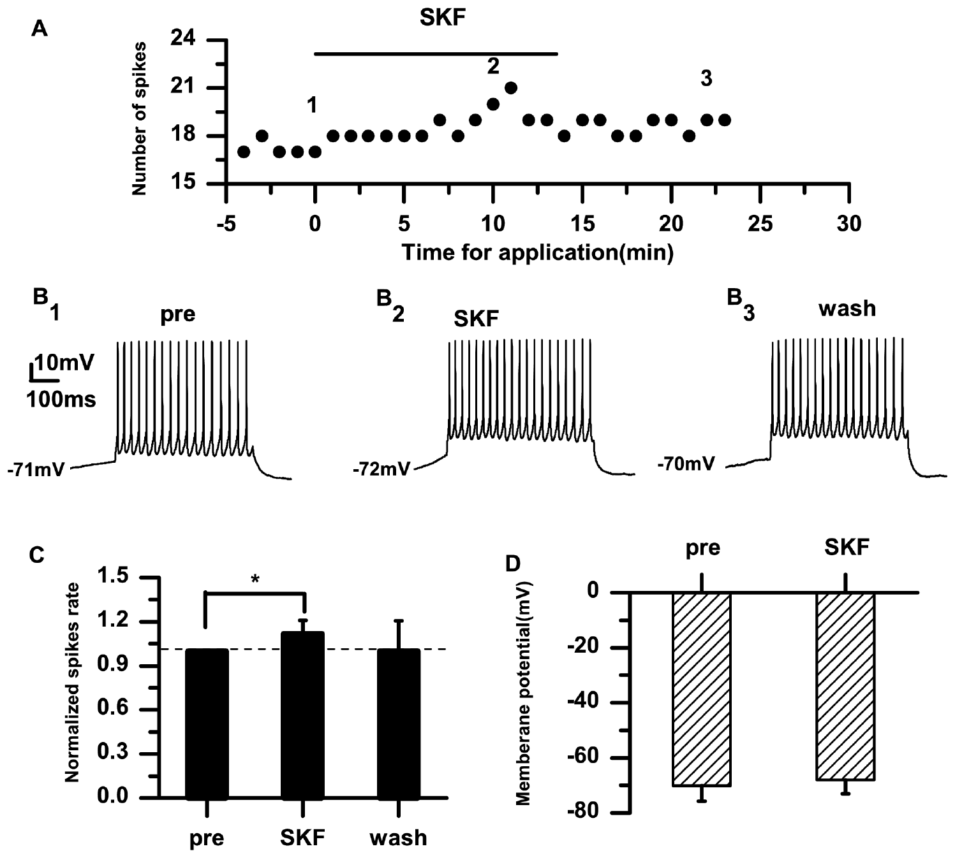
D1-like receptors mediate the RA dopamine effect
A D1-like receptor is a dopamine-receptor class that modulates cellular signaling rather than forming the spike-generating sodium pore. Liao and colleagues compared dopamine with the D1-like agonist SKF-38393 in adult male zebra finch RA projection neurons.
The agonist increased excitability, and the D1-like antagonist SCH-23390 prevented the dopamine-associated increase under the study's conditions. Comparing an agonist with receptor blockade supplied converging pharmacological evidence for the receptor class involved.
The experiments assign a functional contribution to D1-like signaling but do not resolve every receptor subtype, downstream enzyme, or target ion channel. The recorded effect concerns RA membrane physiology; it should not be generalized automatically to dopamine actions in Area X, where circuit organization and receptor effects differ.
Liao et al. (2013), Fig. 3(A–D). D1-like agonist effects on RA neurons.
Zemel et al. (2021), Fig. 1(a, upper). RA and brainstem targets in the vocal motor pathway.
Liao et al. (2013); Zemel et al. (2021)
30
Notes:
• A D1-like receptor is a dopamine-receptor class that modulates cellular signaling rather than forming the spike-generating sodium pore. Liao and colleagues compared dopamine with the D1-like agonist SKF-38393 in adult male zebra finch RA projection neurons.
• The agonist increased excitability, and the D1-like antagonist SCH-23390 prevented the dopamine-associated increase under the study's conditions. Comparing an agonist with receptor blockade supplied converging pharmacological evidence for the receptor class involved.
• The experiments assign a functional contribution to D1-like signaling but do not resolve every receptor subtype, downstream enzyme, or target ion channel. The recorded effect concerns RA membrane physiology; it should not be generalized automatically to dopamine actions in Area X, where circuit organization and receptor effects differ.
References:
Liao C, Wang S, Pan X, Hou G, Li D (2013). Dopamine Modulates the Excitability of Projection Neurons in the Robust Nucleus of the Arcopallium in Adult Zebra Finches. PLoS ONE 8(12):e82497. https://doi.org/10.1371/journal.pone.0082497
Zemel BM, Nevue AA, Dagostin A, Lovell PV, Mello CV, von Gersdorff H (2021). Resurgent Na+ currents promote ultrafast spiking in projection neurons that drive fine motor control. Nature Communications 12(1):6762. https://doi.org/10.1038/s41467-021-26521-3
Figure: Liao et al. (2013), Fig. 3(A–D). D1-like agonist effects on RA neurons.
Figure source: https://doi.org/10.1371/journal.pone.0082497
Figure: Zemel et al. (2021), Fig. 1(a, upper). RA and brainstem targets in the vocal motor pathway.
Figure source: https://doi.org/10.1038/s41467-021-26521-3

Slide 31
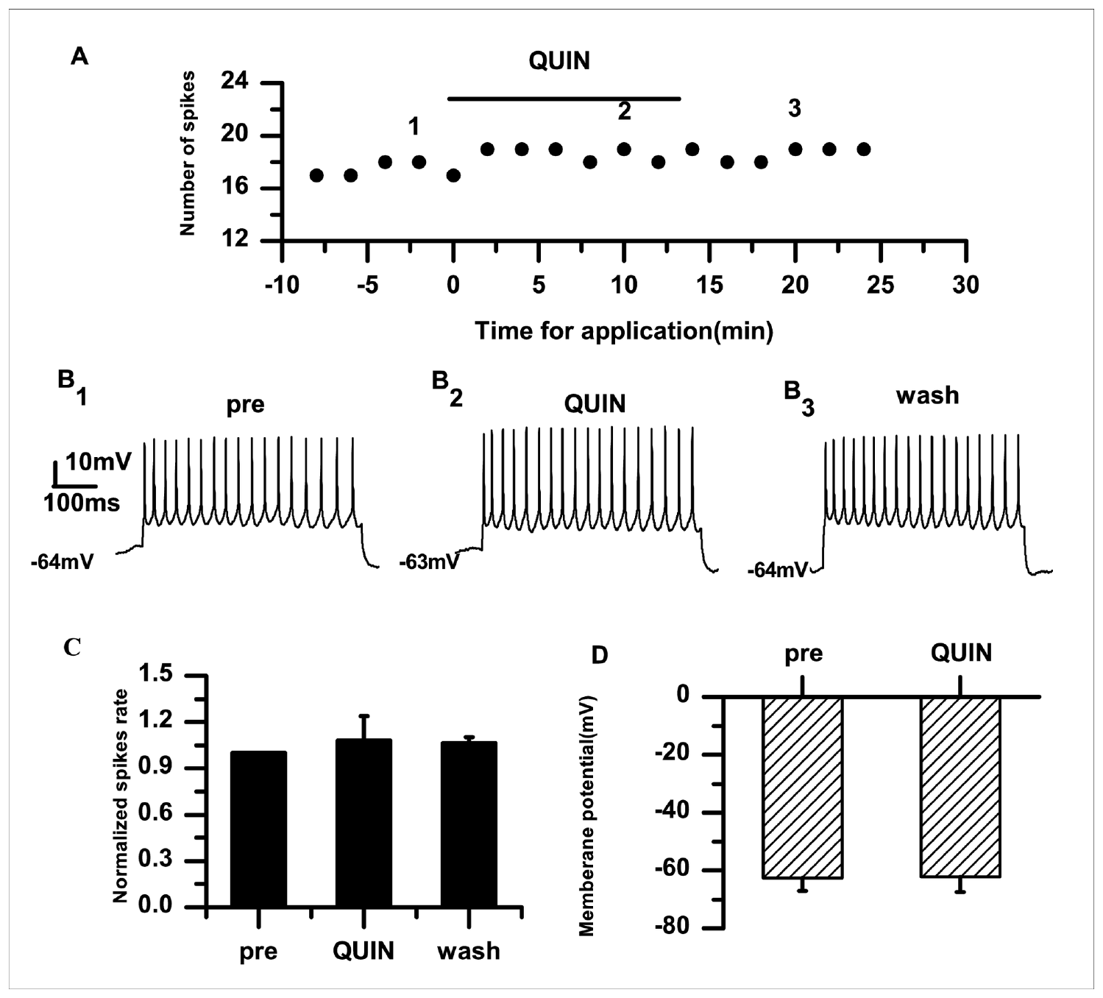
D2-like stimulation has a different effect in RA
D2-like receptors form a dopamine-receptor class pharmacologically distinct from D1-like receptors. Liao and colleagues applied the D2-like agonist quinpirole to RA projection neurons and compared firing and membrane voltage before, during, and after the application.
Quinpirole did not reproduce the prominent increase in excitability produced by dopamine and the D1-like agonist in this preparation. The comparison constrained receptor interpretation instead of assuming that every dopamine receptor has the same effect on a neuron.
A weak or absent effect under these conditions does not establish that D2-like receptors have no function anywhere in the song system. Receptor expression, release conditions, and network targets differ between regions; the study addresses the measured response of adult RA projection neurons in a controlled slice preparation.
Liao et al. (2013), Fig. 5(A–D). D2-like agonist measurements in RA neurons.
Zemel et al. (2021), Fig. 1(a, upper). RA and brainstem targets in the vocal motor pathway.
Liao et al. (2013); Zemel et al. (2021)
31
Notes:
• D2-like receptors form a dopamine-receptor class pharmacologically distinct from D1-like receptors. Liao and colleagues applied the D2-like agonist quinpirole to RA projection neurons and compared firing and membrane voltage before, during, and after the application.
• Quinpirole did not reproduce the prominent increase in excitability produced by dopamine and the D1-like agonist in this preparation. The comparison constrained receptor interpretation instead of assuming that every dopamine receptor has the same effect on a neuron.
• A weak or absent effect under these conditions does not establish that D2-like receptors have no function anywhere in the song system. Receptor expression, release conditions, and network targets differ between regions; the study addresses the measured response of adult RA projection neurons in a controlled slice preparation.
References:
Liao C, Wang S, Pan X, Hou G, Li D (2013). Dopamine Modulates the Excitability of Projection Neurons in the Robust Nucleus of the Arcopallium in Adult Zebra Finches. PLoS ONE 8(12):e82497. https://doi.org/10.1371/journal.pone.0082497
Zemel BM, Nevue AA, Dagostin A, Lovell PV, Mello CV, von Gersdorff H (2021). Resurgent Na+ currents promote ultrafast spiking in projection neurons that drive fine motor control. Nature Communications 12(1):6762. https://doi.org/10.1038/s41467-021-26521-3
Figure: Liao et al. (2013), Fig. 5(A–D). D2-like agonist measurements in RA neurons.
Figure source: https://doi.org/10.1371/journal.pone.0082497
Figure: Zemel et al. (2021), Fig. 1(a, upper). RA and brainstem targets in the vocal motor pathway.
Figure source: https://doi.org/10.1038/s41467-021-26521-3

Slide 32
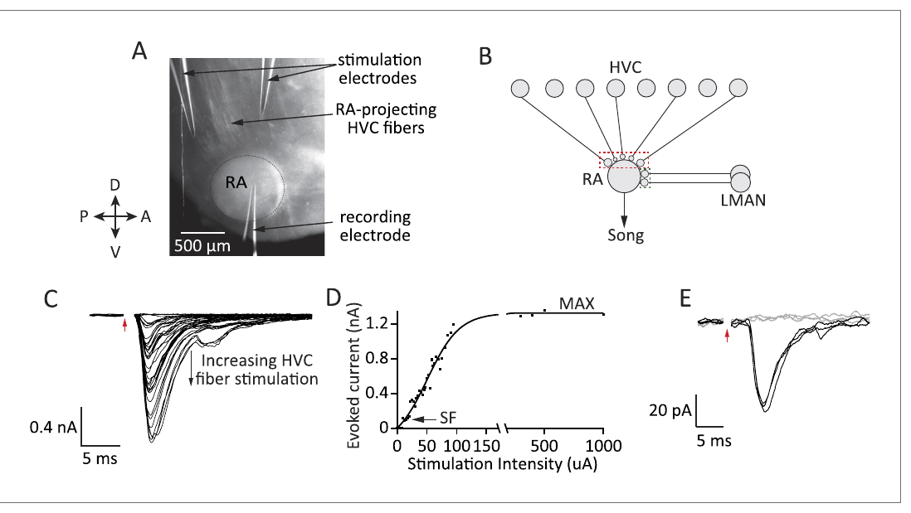
HVC and LMAN inputs converge on RA neurons
The lateral magnocellular nucleus of the anterior nidopallium, or LMAN, is a forebrain output of the anterior forebrain pathway. Garst-Orozco and colleagues stimulated HVC and LMAN fiber tracts separately while recording excitatory postsynaptic currents in RA projection neurons.
An excitatory postsynaptic current is the membrane current produced when excitatory transmitter activates receptors on the recorded cell. Pathway-specific stimulation allowed the strength and receptor contributions of the two convergent inputs to be compared in juvenile and adult zebra finches.
RA therefore receives input from a direct motor-related pathway and from a basal ganglia–thalamic pathway. Electrical stimulation in slices samples surviving fibers rather than every connection present in the intact animal, and does not reveal the natural activity pattern of those inputs during a particular syllable.
Garst-Orozco et al. (2014), Fig. 2(A–E). Pathway stimulation and currents recorded in RA.
Garst-Orozco et al. (2014)
32
Notes:
• The lateral magnocellular nucleus of the anterior nidopallium, or LMAN, is a forebrain output of the anterior forebrain pathway. Garst-Orozco and colleagues stimulated HVC and LMAN fiber tracts separately while recording excitatory postsynaptic currents in RA projection neurons.
• An excitatory postsynaptic current is the membrane current produced when excitatory transmitter activates receptors on the recorded cell. Pathway-specific stimulation allowed the strength and receptor contributions of the two convergent inputs to be compared in juvenile and adult zebra finches.
• RA therefore receives input from a direct motor-related pathway and from a basal ganglia–thalamic pathway. Electrical stimulation in slices samples surviving fibers rather than every connection present in the intact animal, and does not reveal the natural activity pattern of those inputs during a particular syllable.
References:
Garst-Orozco J, Babadi B, Ölveczky BP (2014). A neural circuit mechanism for regulating vocal variability during song learning in zebra finches. eLife 3:e03697. https://doi.org/10.7554/elife.03697
Figure: Garst-Orozco et al. (2014), Fig. 2(A–E). Pathway stimulation and currents recorded in RA.
Figure source: https://doi.org/10.7554/elife.03697

Slide 33
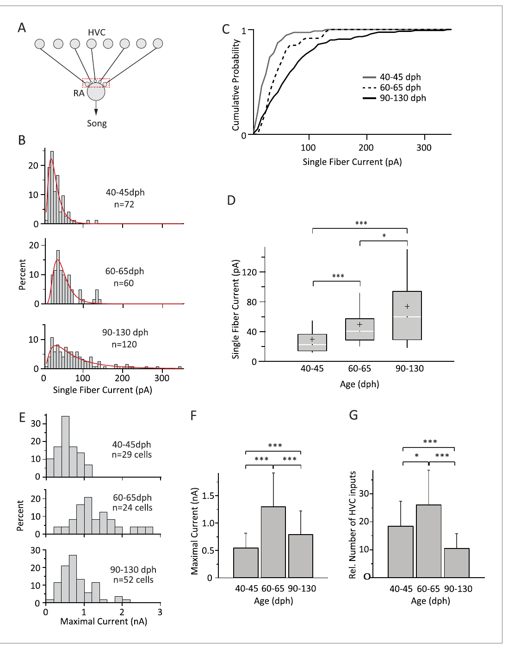
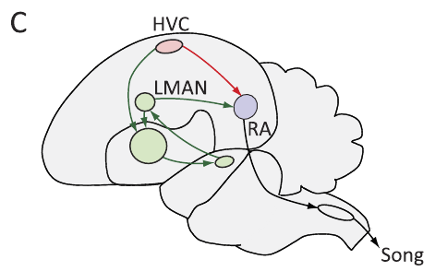
HVC inputs strengthen and undergo late refinement
Garst-Orozco and colleagues measured HVC-to-RA currents using weak stimulation that produced either failures or a consistent single-fiber response, and stronger stimulation that recruited the available input population. Comparing these measurements distinguished connection strength from the estimated number of recruited inputs.
Median single-fiber HVC currents rose from about 23 pA in subsong birds to 60 pA in adults. Estimated input number initially increased, then declined during later development. The experiment therefore identified refinement rather than a uniform increase in every aspect of excitatory connectivity.
Such strengthening and pruning can alter how RA converts HVC activity into motor output. The measurements do not establish that each lost input was an incorrect connection for a particular tutor song, and the fiber-number estimate is limited by slice preservation and assumptions about recruitment and current summation.
Garst-Orozco et al. (2014), Fig. 3(A–G). HVC input strengthening and refinement.
Garst-Orozco et al. (2014), Fig. 1(C). HVC, LMAN, and RA in the published pathway map.
Garst-Orozco et al. (2014)
33
Notes:
• Garst-Orozco and colleagues measured HVC-to-RA currents using weak stimulation that produced either failures or a consistent single-fiber response, and stronger stimulation that recruited the available input population. Comparing these measurements distinguished connection strength from the estimated number of recruited inputs.
• Median single-fiber HVC currents rose from about 23 pA in subsong birds to 60 pA in adults. Estimated input number initially increased, then declined during later development. The experiment therefore identified refinement rather than a uniform increase in every aspect of excitatory connectivity.
• Such strengthening and pruning can alter how RA converts HVC activity into motor output. The measurements do not establish that each lost input was an incorrect connection for a particular tutor song, and the fiber-number estimate is limited by slice preservation and assumptions about recruitment and current summation.
References:
Garst-Orozco J, Babadi B, Ölveczky BP (2014). A neural circuit mechanism for regulating vocal variability during song learning in zebra finches. eLife 3:e03697. https://doi.org/10.7554/elife.03697
Figure: Garst-Orozco et al. (2014), Fig. 3(A–G). HVC input strengthening and refinement.
Figure source: https://doi.org/10.7554/elife.03697
Figure: Garst-Orozco et al. (2014), Fig. 1(C). HVC, LMAN, and RA in the published pathway map.
Figure source: https://doi.org/10.7554/elife.03697

Slide 34
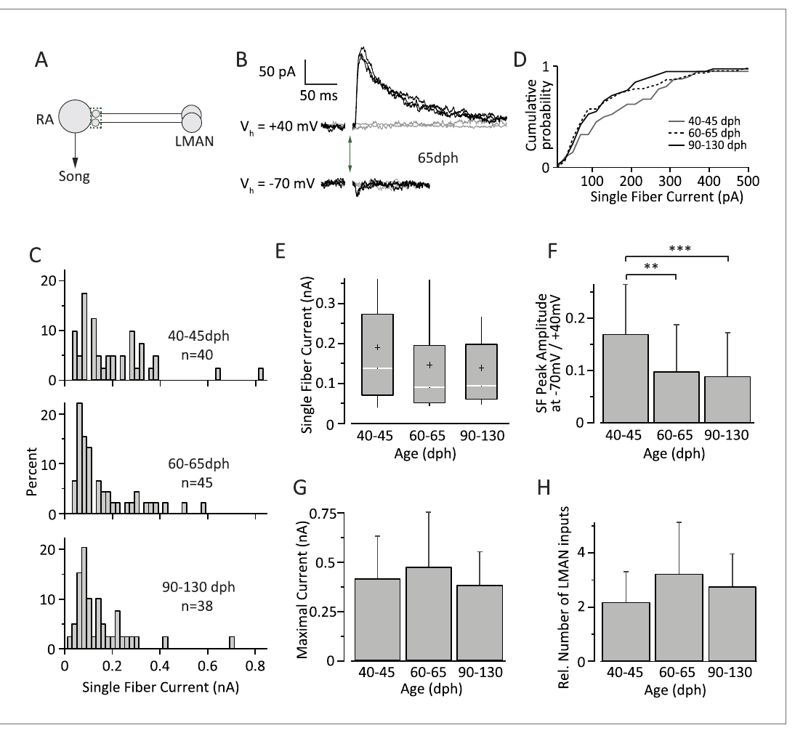
LMAN input strength remains relatively stable
Garst-Orozco and colleagues applied the same single-fiber and maximal-recruitment strategy to the LMAN input onto RA neurons. Recordings from subsong, plastic-song, and adult birds tested whether increasing song stereotypy reflected a simple disappearance of this excitatory pathway.
Mean single-fiber LMAN currents were approximately 146 pA in plastic-song birds and 142 pA in adults; the estimated number of available inputs remained relatively stable. The finding contrasted with the strengthening and pruning of HVC inputs measured in the same experimental framework.
Reduced behavioral variability can consequently coexist with persistent LMAN-to-RA connectivity. The result does not establish that LMAN firing patterns or synaptic effects are identical in behaving juveniles and adults; a preserved connection can have a different influence when other convergent inputs and network activity change.
Garst-Orozco et al. (2014), Fig. 4(A–H). LMAN current strength and receptor contributions.
Garst-Orozco et al. (2014), Fig. 1(C). HVC, LMAN, and RA in the published pathway map.
Garst-Orozco et al. (2014)
34
Notes:
• Garst-Orozco and colleagues applied the same single-fiber and maximal-recruitment strategy to the LMAN input onto RA neurons. Recordings from subsong, plastic-song, and adult birds tested whether increasing song stereotypy reflected a simple disappearance of this excitatory pathway.
• Mean single-fiber LMAN currents were approximately 146 pA in plastic-song birds and 142 pA in adults; the estimated number of available inputs remained relatively stable. The finding contrasted with the strengthening and pruning of HVC inputs measured in the same experimental framework.
• Reduced behavioral variability can consequently coexist with persistent LMAN-to-RA connectivity. The result does not establish that LMAN firing patterns or synaptic effects are identical in behaving juveniles and adults; a preserved connection can have a different influence when other convergent inputs and network activity change.
References:
Garst-Orozco J, Babadi B, Ölveczky BP (2014). A neural circuit mechanism for regulating vocal variability during song learning in zebra finches. eLife 3:e03697. https://doi.org/10.7554/elife.03697
Figure: Garst-Orozco et al. (2014), Fig. 4(A–H). LMAN current strength and receptor contributions.
Figure source: https://doi.org/10.7554/elife.03697
Figure: Garst-Orozco et al. (2014), Fig. 1(C). HVC, LMAN, and RA in the published pathway map.
Figure source: https://doi.org/10.7554/elife.03697

Slide 35
LMAN currents depend strongly on NMDA receptors
Garst-Orozco and colleagues recorded LMAN-evoked currents at −70 and +40 mV. At negative voltages, extracellular magnesium limits NMDA-receptor current; depolarization relieves this voltage-dependent block, allowing the slower receptor component to contribute more strongly.
The comparison distinguished predominantly AMPA-mediated responses at −70 mV from the combined AMPA and NMDA response at +40 mV. The estimated NMDA-to-AMPA contribution in subsong birds was approximately 9:1. LMAN responses had a substantial NMDA component, connecting pathway identity to a particular form of postsynaptic integration rather than treating all excitatory inputs as interchangeable.
Voltage-dependent gating means that the effect of LMAN input depends partly on the postsynaptic state of RA. The recordings establish receptor contributions under imposed holding potentials, but cannot by themselves specify RA voltage trajectories or transmitter release during freely produced song.
Garst-Orozco et al. (2014), Fig. 4(A–H). LMAN current strength and receptor contributions.
Garst-Orozco et al. (2014), Fig. 1(C). HVC, LMAN, and RA in the published pathway map.
Garst-Orozco et al. (2014)
35
Notes:
• Garst-Orozco and colleagues recorded LMAN-evoked currents at −70 and +40 mV. At negative voltages, extracellular magnesium limits NMDA-receptor current; depolarization relieves this voltage-dependent block, allowing the slower receptor component to contribute more strongly.
• The comparison distinguished predominantly AMPA-mediated responses at −70 mV from the combined AMPA and NMDA response at +40 mV. The estimated NMDA-to-AMPA contribution in subsong birds was approximately 9:1. LMAN responses had a substantial NMDA component, connecting pathway identity to a particular form of postsynaptic integration rather than treating all excitatory inputs as interchangeable.
• Voltage-dependent gating means that the effect of LMAN input depends partly on the postsynaptic state of RA. The recordings establish receptor contributions under imposed holding potentials, but cannot by themselves specify RA voltage trajectories or transmitter release during freely produced song.
References:
Garst-Orozco J, Babadi B, Ölveczky BP (2014). A neural circuit mechanism for regulating vocal variability during song learning in zebra finches. eLife 3:e03697. https://doi.org/10.7554/elife.03697
Figure: Garst-Orozco et al. (2014), Fig. 4(A–H). LMAN current strength and receptor contributions.
Figure source: https://doi.org/10.7554/elife.03697
Figure: Garst-Orozco et al. (2014), Fig. 1(C). HVC, LMAN, and RA in the published pathway map.
Figure source: https://doi.org/10.7554/elife.03697

Slide 36
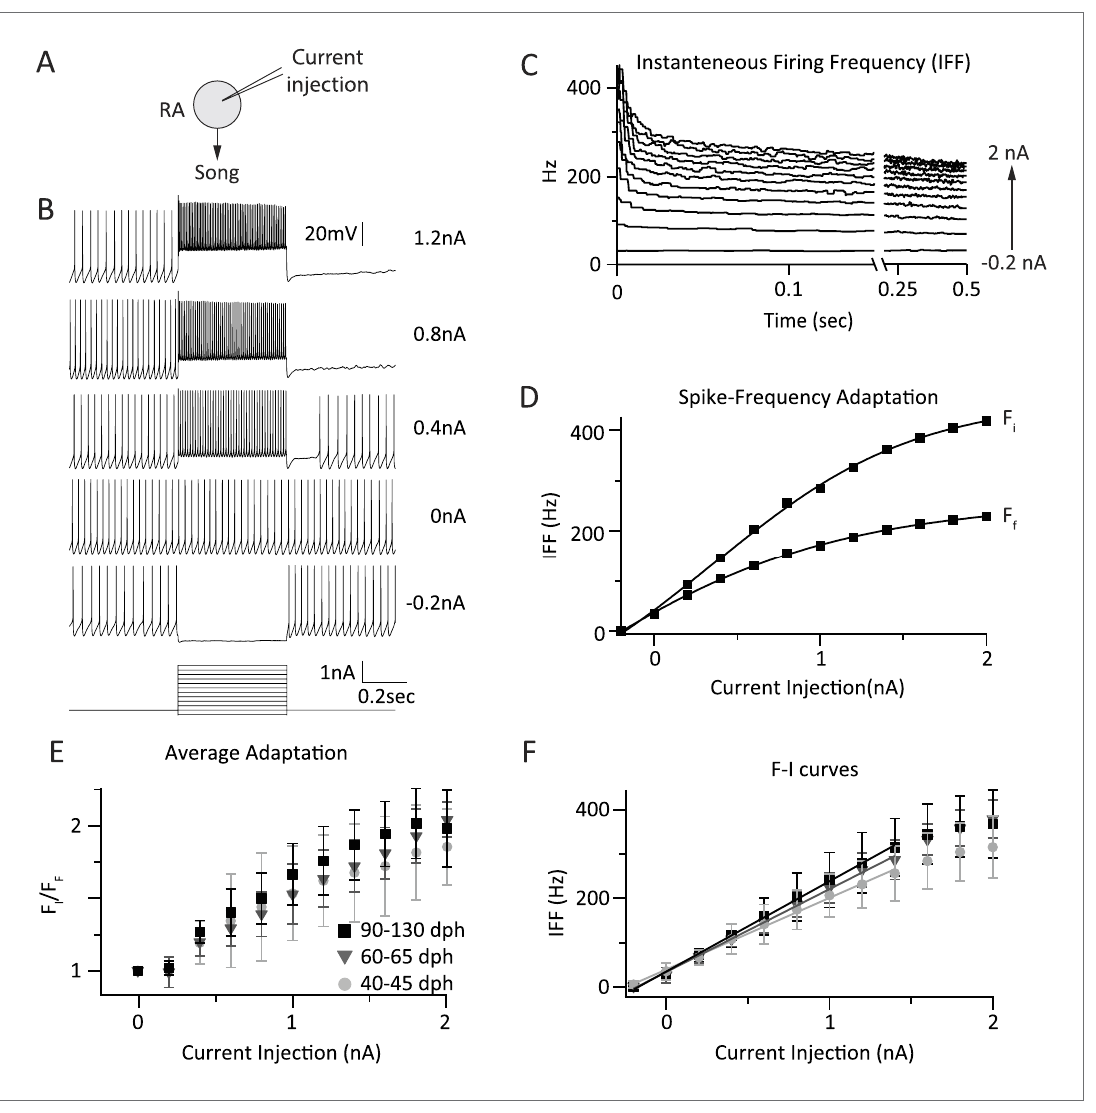
Developmental conclusions depend on the age window
Garst-Orozco and colleagues measured RA responses to 0.5-second current pulses at 35 °C across subsong, plastic-song, and adult stages. Input-to-firing gain and spike-frequency adaptation were broadly similar across these groups, constraining a simple intrinsic-excitability explanation of reduced song variability.
Zemel and colleagues included younger 20-day birds and isolated sodium-current components, detecting pronounced maturation of resurgent current and spike properties. The studies differ in developmental window, recording conditions, and the physiological property being measured.
A stable firing-rate response over one age interval does not contradict earlier maturation of a particular ion current. Neither experiment supports a universal statement that RA intrinsic properties never change, nor that all decreases in song variability are caused by sodium-channel maturation.
Garst-Orozco et al. (2014), Fig. 5(A–F). RA firing responses across developmental stages.
Garst-Orozco et al. (2014), Fig. 1(C). HVC, LMAN, and RA in the published pathway map.
Garst-Orozco et al. (2014); Zemel et al. (2021)
36
Notes:
• Garst-Orozco and colleagues measured RA responses to 0.5-second current pulses at 35 °C across subsong, plastic-song, and adult stages. Input-to-firing gain and spike-frequency adaptation were broadly similar across these groups, constraining a simple intrinsic-excitability explanation of reduced song variability.
• Zemel and colleagues included younger 20-day birds and isolated sodium-current components, detecting pronounced maturation of resurgent current and spike properties. The studies differ in developmental window, recording conditions, and the physiological property being measured.
• A stable firing-rate response over one age interval does not contradict earlier maturation of a particular ion current. Neither experiment supports a universal statement that RA intrinsic properties never change, nor that all decreases in song variability are caused by sodium-channel maturation.
References:
Garst-Orozco J, Babadi B, Ölveczky BP (2014). A neural circuit mechanism for regulating vocal variability during song learning in zebra finches. eLife 3:e03697. https://doi.org/10.7554/elife.03697
Zemel BM, Nevue AA, Dagostin A, Lovell PV, Mello CV, von Gersdorff H (2021). Resurgent Na+ currents promote ultrafast spiking in projection neurons that drive fine motor control. Nature Communications 12(1):6762. https://doi.org/10.1038/s41467-021-26521-3
Figure: Garst-Orozco et al. (2014), Fig. 5(A–F). RA firing responses across developmental stages.
Figure source: https://doi.org/10.7554/elife.03697
Figure: Garst-Orozco et al. (2014), Fig. 1(C). HVC, LMAN, and RA in the published pathway map.
Figure source: https://doi.org/10.7554/elife.03697

Slide 37
Juvenile and adult lesions separate LMAN functions
Bottjer and colleagues lesioned the region then called MAN in male zebra finches at different stages of song development. Postoperative vocalizations were recorded repeatedly, and histology distinguished complete lesions from cases in which the intended region was largely spared.
Lesions early in development produced abnormal vocal patterns, whereas adult birds with complete bilateral lesions retained normal song for as long as five weeks. Birds operated at intermediate stages differed according to how established their song pattern was before surgery.
The age dependence separates a contribution to developing vocal behavior from an obligatory role in executing established adult song. It does not prove that LMAN stores the tutor memory or that adult LMAN has no function; later pathway-specific physiology identifies persistent input to RA even after song stabilizes.
Garst-Orozco et al. (2014), Fig. 1(C). HVC, LMAN, and RA in the published pathway map.
Bottjer et al. (1984); Garst-Orozco et al. (2014)
37
Notes:
• Bottjer and colleagues lesioned the region then called MAN in male zebra finches at different stages of song development. Postoperative vocalizations were recorded repeatedly, and histology distinguished complete lesions from cases in which the intended region was largely spared.
• Lesions early in development produced abnormal vocal patterns, whereas adult birds with complete bilateral lesions retained normal song for as long as five weeks. Birds operated at intermediate stages differed according to how established their song pattern was before surgery.
• The age dependence separates a contribution to developing vocal behavior from an obligatory role in executing established adult song. It does not prove that LMAN stores the tutor memory or that adult LMAN has no function; later pathway-specific physiology identifies persistent input to RA even after song stabilizes.
References:
Bottjer SW, Miesner EA, Arnold AP (1984). Forebrain Lesions Disrupt Development But Not Maintenance of Song in Passerine Birds. Science 224(4651):901-903. https://doi.org/10.1126/science.6719123
Garst-Orozco J, Babadi B, Ölveczky BP (2014). A neural circuit mechanism for regulating vocal variability during song learning in zebra finches. eLife 3:e03697. https://doi.org/10.7554/elife.03697
Figure: Garst-Orozco et al. (2014), Fig. 1(C). HVC, LMAN, and RA in the published pathway map.
Figure source: https://doi.org/10.7554/elife.03697

Slide 38
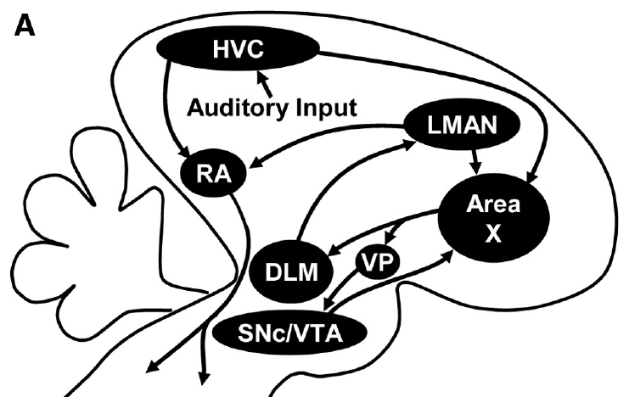
Area X links striatal processing with pallidal output
Area X is a song-related basal ganglia region containing striatal-like neurons and pallidal-like output neurons. The basal ganglia are forebrain circuits involved in selecting and modifying actions; these cell classes have different positions within the circuit rather than forming one homogeneous population.
Area X receives HVC and LMAN input and sends inhibitory output toward the medial portion of the dorsolateral thalamic nucleus, DLM. DLM projects to LMAN, whose output returns to RA and also to Area X, producing an anatomically connected forebrain loop.
GABA, gamma-aminobutyric acid, is the inhibitory transmitter associated with the pallidal-like output. The published anatomical pathway constrains possible mechanisms, but a connection diagram alone does not determine the moment-to-moment activity or learning rule operating in that loop.
Gale & Perkel (2010a), Fig. 1(A). Area X, DLM, LMAN, and midbrain connections.
Gale & Perkel (2010b); Gale & Perkel (2010a)
38
Notes:
• Area X is a song-related basal ganglia region containing striatal-like neurons and pallidal-like output neurons. The basal ganglia are forebrain circuits involved in selecting and modifying actions; these cell classes have different positions within the circuit rather than forming one homogeneous population.
• Area X receives HVC and LMAN input and sends inhibitory output toward the medial portion of the dorsolateral thalamic nucleus, DLM. DLM projects to LMAN, whose output returns to RA and also to Area X, producing an anatomically connected forebrain loop.
• GABA, gamma-aminobutyric acid, is the inhibitory transmitter associated with the pallidal-like output. The published anatomical pathway constrains possible mechanisms, but a connection diagram alone does not determine the moment-to-moment activity or learning rule operating in that loop.
References:
Gale SD, Perkel DJ (2010b). Anatomy of a songbird basal ganglia circuit essential for vocal learning and plasticity. Journal of Chemical Neuroanatomy 39(2):124-131. https://doi.org/10.1016/j.jchemneu.2009.07.003
Gale SD, Perkel DJ (2010a). A Basal Ganglia Pathway Drives Selective Auditory Responses in Songbird Dopaminergic Neurons via Disinhibition. The Journal of Neuroscience 30(3):1027-1037. https://doi.org/10.1523/jneurosci.3585-09.2010
Figure: Gale & Perkel (2010a), Fig. 1(A). Area X, DLM, LMAN, and midbrain connections.
Figure source: https://doi.org/10.1523/jneurosci.3585-09.2010

Slide 39
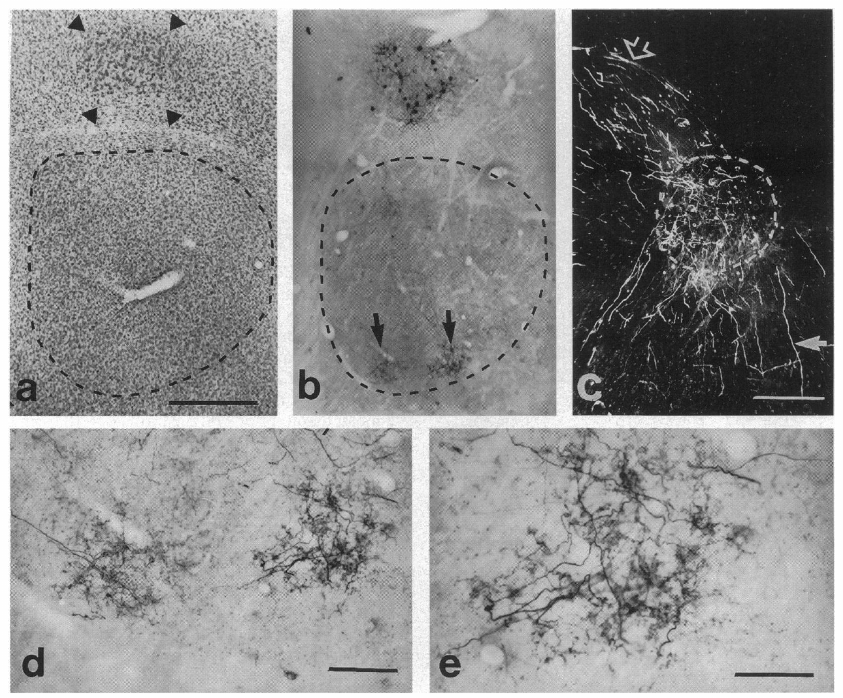
Tracer injections reveal reciprocal forebrain routes
A retrograde tracer labels neurons projecting toward an injection site, whereas an anterograde tracer labels their axons and terminals downstream. Vates and Nottebohm used complementary tracing approaches to investigate pathways linking the song-related forebrain nuclei.
Injections associated with Area X and RA labeled neurons and terminal fields in LMAN. These distributions supported an LMAN output route to both the basal ganglia region and the motor nucleus, extending the circuit beyond a one-way chain from HVC to the vocal organ.
Using more than one tracer direction reduces ambiguity about which cells send and receive a projection. Tracer labeling nevertheless does not establish whether every anatomical connection is active during song, identify the transmitter at every terminal, or measure the temporal influence of a synapse on its target.
Vates & Nottebohm (1995), Fig. 3(a–e). Tracer labeling linking LMAN, Area X, and RA.
Vates & Nottebohm (1995)
39
Notes:
• A retrograde tracer labels neurons projecting toward an injection site, whereas an anterograde tracer labels their axons and terminals downstream. Vates and Nottebohm used complementary tracing approaches to investigate pathways linking the song-related forebrain nuclei.
• Injections associated with Area X and RA labeled neurons and terminal fields in LMAN. These distributions supported an LMAN output route to both the basal ganglia region and the motor nucleus, extending the circuit beyond a one-way chain from HVC to the vocal organ.
• Using more than one tracer direction reduces ambiguity about which cells send and receive a projection. Tracer labeling nevertheless does not establish whether every anatomical connection is active during song, identify the transmitter at every terminal, or measure the temporal influence of a synapse on its target.
References:
Vates GE, Nottebohm F (1995). Feedback circuitry within a song-learning pathway.. Proceedings of the National Academy of Sciences 92(11):5139-5143. https://doi.org/10.1073/pnas.92.11.5139
Figure: Vates & Nottebohm (1995), Fig. 3(a–e). Tracer labeling linking LMAN, Area X, and RA.
Figure source: https://doi.org/10.1073/pnas.92.11.5139

Slide 40
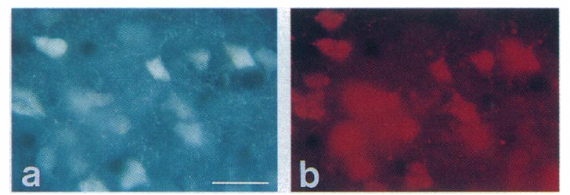
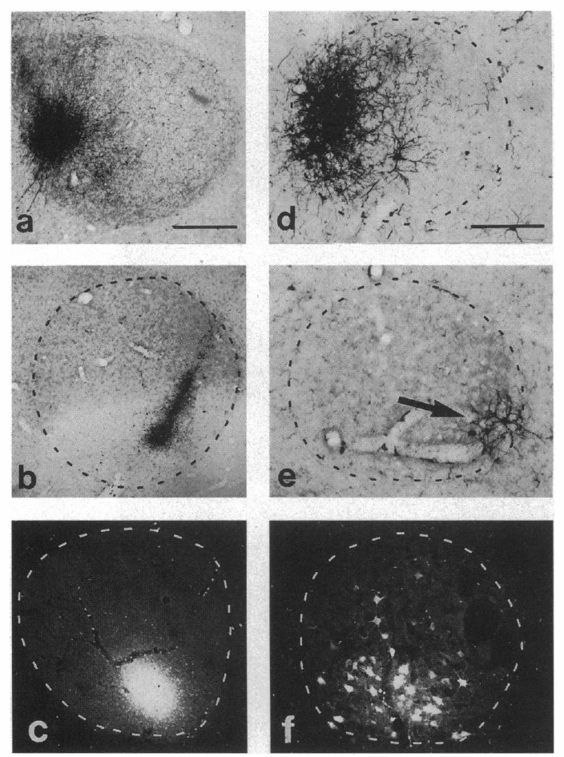
Some LMAN neurons send output to both RA and Area X
Vates and Nottebohm placed different retrograde tracers in RA and Area X to ask whether the two projections originated from separate LMAN populations. Neurons containing both labels were identified within LMAN, providing evidence of output toward both targets from individual cells.
This result is more specific than overlapping terminal fields: it links the two target regions to a shared projecting neuron. A neuron with branching output can influence RA motor circuitry while also returning activity to the anterior forebrain loop through Area X.
Double labeling identifies anatomical collateralization, not the information carried by each branch. Uptake and transport efficiencies also limit interpretation of unlabeled cells, so failure to detect a second label in one neuron does not prove that all of its axonal branches avoid the other target.
Vates & Nottebohm (1995), Fig. 5(a–b). Two retrograde labels in LMAN neurons.
Vates & Nottebohm (1995), Fig. 4(a–f). Injection sites and retrogradely labeled LMAN cells.
Vates & Nottebohm (1995)
40
Notes:
• Vates and Nottebohm placed different retrograde tracers in RA and Area X to ask whether the two projections originated from separate LMAN populations. Neurons containing both labels were identified within LMAN, providing evidence of output toward both targets from individual cells.
• This result is more specific than overlapping terminal fields: it links the two target regions to a shared projecting neuron. A neuron with branching output can influence RA motor circuitry while also returning activity to the anterior forebrain loop through Area X.
• Double labeling identifies anatomical collateralization, not the information carried by each branch. Uptake and transport efficiencies also limit interpretation of unlabeled cells, so failure to detect a second label in one neuron does not prove that all of its axonal branches avoid the other target.
References:
Vates GE, Nottebohm F (1995). Feedback circuitry within a song-learning pathway.. Proceedings of the National Academy of Sciences 92(11):5139-5143. https://doi.org/10.1073/pnas.92.11.5139
Figure: Vates & Nottebohm (1995), Fig. 5(a–b). Two retrograde labels in LMAN neurons.
Figure source: https://doi.org/10.1073/pnas.92.11.5139
Figure: Vates & Nottebohm (1995), Fig. 4(a–f). Injection sites and retrogradely labeled LMAN cells.
Figure source: https://doi.org/10.1073/pnas.92.11.5139

Slide 41
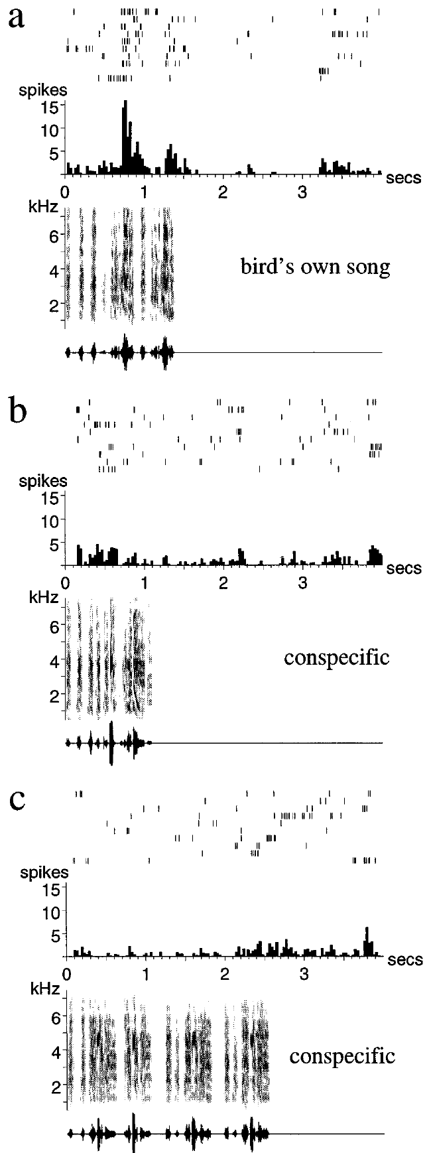
Adult LMAN neurons respond selectively to the bird's song
Doupe recorded extracellular spikes from LMAN while playing the bird's own song and comparison sounds to anesthetized adult zebra finches. A raster plot records individual spike times across repeated trials; averaging these trials yields the time-dependent firing-rate response.
Many neurons responded strongly to the bird's own song but weakly to other conspecific songs or simple acoustic stimuli. Comparisons with amplitude-modulated noise and tones tested whether a response could be explained by a generic sound-energy change alone.
The selectivity links an anterior forebrain nucleus with the acoustic structure of learned vocal behavior. Because these were playback responses under anesthesia, they do not establish that LMAN monitors song identically during awake singing or that the selective response is itself an error signal.
Doupe (1997), Fig. 2(a–c). LMAN responses to self-song and comparison songs.
Gale & Perkel (2010a), Fig. 1(A). Area X, DLM, LMAN, and midbrain connections.
Doupe (1997); Gale & Perkel (2010a)
41
Notes:
• Doupe recorded extracellular spikes from LMAN while playing the bird's own song and comparison sounds to anesthetized adult zebra finches. A raster plot records individual spike times across repeated trials; averaging these trials yields the time-dependent firing-rate response.
• Many neurons responded strongly to the bird's own song but weakly to other conspecific songs or simple acoustic stimuli. Comparisons with amplitude-modulated noise and tones tested whether a response could be explained by a generic sound-energy change alone.
• The selectivity links an anterior forebrain nucleus with the acoustic structure of learned vocal behavior. Because these were playback responses under anesthesia, they do not establish that LMAN monitors song identically during awake singing or that the selective response is itself an error signal.
References:
Doupe AJ (1997). Song- and Order-Selective Neurons in the Songbird Anterior Forebrain and their Emergence during Vocal Development. The Journal of Neuroscience 17(3):1147-1167. https://doi.org/10.1523/jneurosci.17-03-01147.1997
Gale SD, Perkel DJ (2010a). A Basal Ganglia Pathway Drives Selective Auditory Responses in Songbird Dopaminergic Neurons via Disinhibition. The Journal of Neuroscience 30(3):1027-1037. https://doi.org/10.1523/jneurosci.3585-09.2010
Figure: Doupe (1997), Fig. 2(a–c). LMAN responses to self-song and comparison songs.
Figure source: https://doi.org/10.1523/jneurosci.17-03-01147.1997
Figure: Gale & Perkel (2010a), Fig. 1(A). Area X, DLM, LMAN, and midbrain connections.
Figure source: https://doi.org/10.1523/jneurosci.3585-09.2010

Slide 42
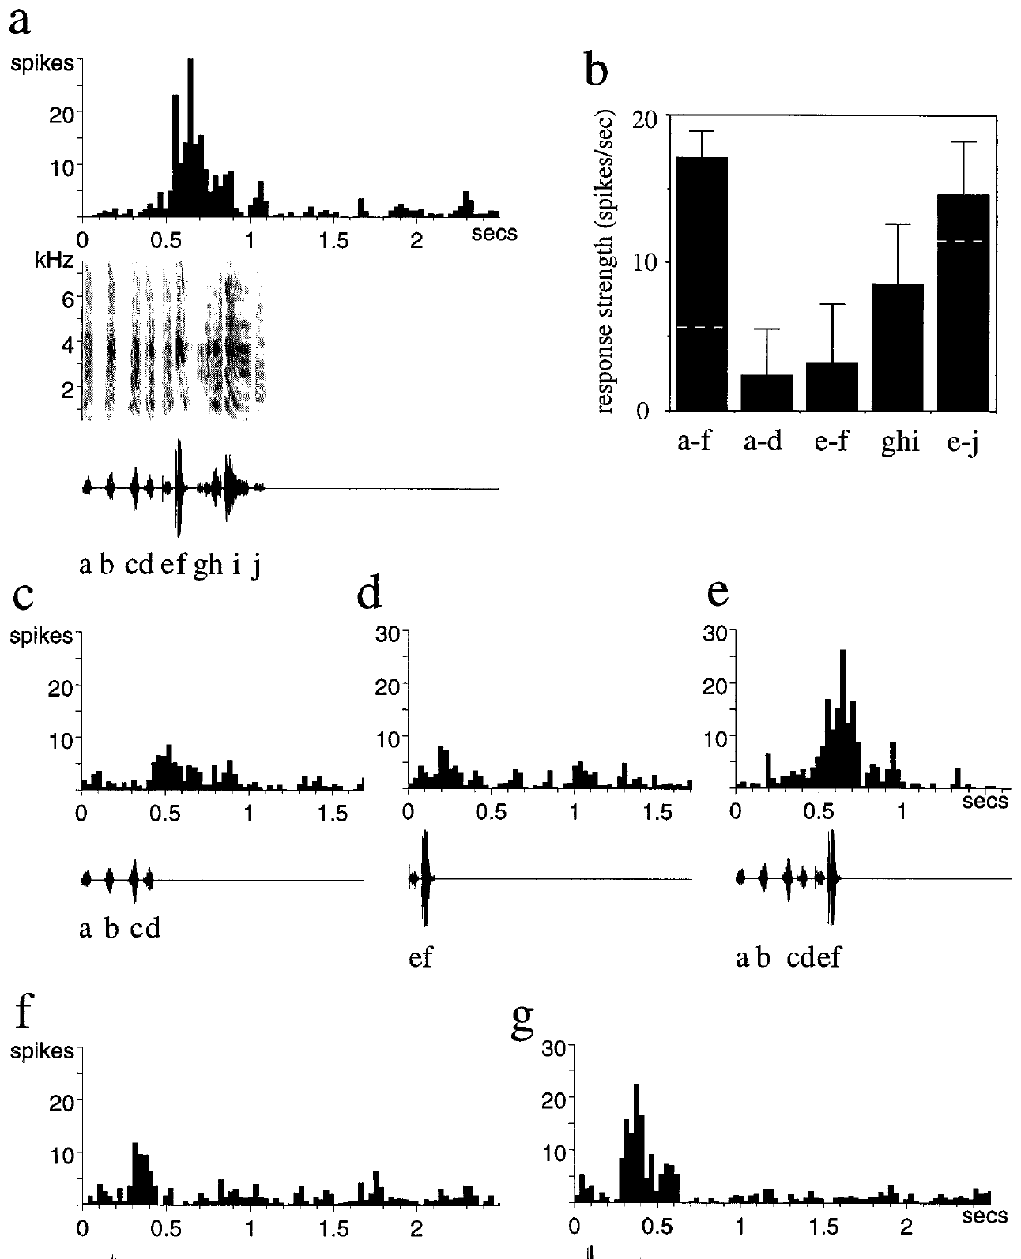
LMAN selectivity includes temporal order
Doupe compared responses to intact song with altered versions in which the order or arrangement of song elements was changed. A syllable is a recognizable acoustic unit; reorganizing syllables preserves many local acoustic features while changing their temporal context.
Some LMAN neurons responded more strongly to the normal sequence than to rearrangements or isolated combinations. Such comparisons tested whether selectivity depended only on an individual sound fragment or also on the relationship between fragments across time.
Temporal-order sensitivity is consistent with integration of a learned sequence rather than detection of a single frequency alone. It does not identify a complete synaptic mechanism for the selectivity, and responses to experimental rearrangements cannot by themselves distinguish recognition, prediction, and vocal-learning functions in the behaving animal.
Doupe (1997), Fig. 7(a–g). Responses to combinations of song syllables.
Gale & Perkel (2010a), Fig. 1(A). Area X, DLM, LMAN, and midbrain connections.
Doupe (1997); Gale & Perkel (2010a)
42
Notes:
• Doupe compared responses to intact song with altered versions in which the order or arrangement of song elements was changed. A syllable is a recognizable acoustic unit; reorganizing syllables preserves many local acoustic features while changing their temporal context.
• Some LMAN neurons responded more strongly to the normal sequence than to rearrangements or isolated combinations. Such comparisons tested whether selectivity depended only on an individual sound fragment or also on the relationship between fragments across time.
• Temporal-order sensitivity is consistent with integration of a learned sequence rather than detection of a single frequency alone. It does not identify a complete synaptic mechanism for the selectivity, and responses to experimental rearrangements cannot by themselves distinguish recognition, prediction, and vocal-learning functions in the behaving animal.
References:
Doupe AJ (1997). Song- and Order-Selective Neurons in the Songbird Anterior Forebrain and their Emergence during Vocal Development. The Journal of Neuroscience 17(3):1147-1167. https://doi.org/10.1523/jneurosci.17-03-01147.1997
Gale SD, Perkel DJ (2010a). A Basal Ganglia Pathway Drives Selective Auditory Responses in Songbird Dopaminergic Neurons via Disinhibition. The Journal of Neuroscience 30(3):1027-1037. https://doi.org/10.1523/jneurosci.3585-09.2010
Figure: Doupe (1997), Fig. 7(a–g). Responses to combinations of song syllables.
Figure source: https://doi.org/10.1523/jneurosci.17-03-01147.1997
Figure: Gale & Perkel (2010a), Fig. 1(A). Area X, DLM, LMAN, and midbrain connections.
Figure source: https://doi.org/10.1523/jneurosci.3585-09.2010

Slide 43
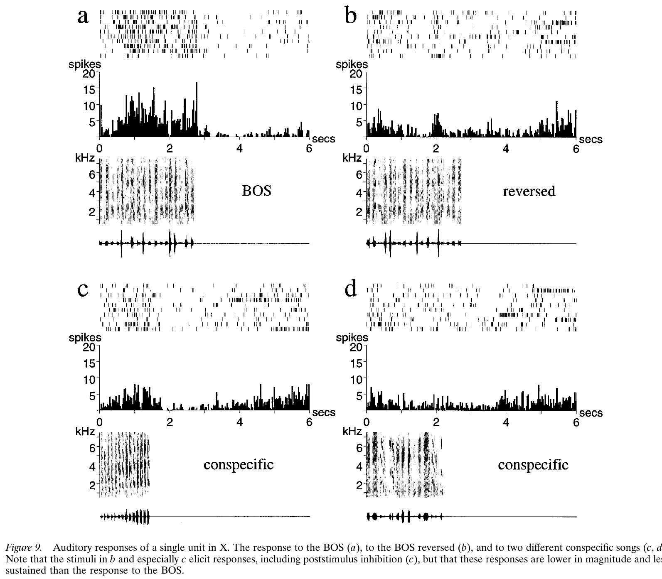
Area X also carries song-selective auditory responses
Doupe recorded auditory responses in Area X using the bird's own song, reversed song, and songs from other zebra finches. Comparing multiple stimuli within the same neuron controlled for differences in overall excitability between cells and recording sites.
Area X neurons exhibited selective responses to familiar self-song, with responses influenced by the temporal structure of the playback. Auditory selectivity was therefore present within the basal ganglia portion of the anterior forebrain pathway, rather than being restricted to its LMAN output.
These findings establish sensory responsiveness in a song-related circuit but do not equate Area X with an auditory storage site. The extracellular recording does not identify every neuron's cell class, and the anesthetized playback preparation differs from the sensory and motor conditions during natural courtship song.
Doupe (1997), Fig. 9(a–d). Song-selective auditory responses in Area X.
Gale & Perkel (2010a), Fig. 1(A). Area X, DLM, LMAN, and midbrain connections.
Doupe (1997); Gale & Perkel (2010a)
43
Notes:
• Doupe recorded auditory responses in Area X using the bird's own song, reversed song, and songs from other zebra finches. Comparing multiple stimuli within the same neuron controlled for differences in overall excitability between cells and recording sites.
• Area X neurons exhibited selective responses to familiar self-song, with responses influenced by the temporal structure of the playback. Auditory selectivity was therefore present within the basal ganglia portion of the anterior forebrain pathway, rather than being restricted to its LMAN output.
• These findings establish sensory responsiveness in a song-related circuit but do not equate Area X with an auditory storage site. The extracellular recording does not identify every neuron's cell class, and the anesthetized playback preparation differs from the sensory and motor conditions during natural courtship song.
References:
Doupe AJ (1997). Song- and Order-Selective Neurons in the Songbird Anterior Forebrain and their Emergence during Vocal Development. The Journal of Neuroscience 17(3):1147-1167. https://doi.org/10.1523/jneurosci.17-03-01147.1997
Gale SD, Perkel DJ (2010a). A Basal Ganglia Pathway Drives Selective Auditory Responses in Songbird Dopaminergic Neurons via Disinhibition. The Journal of Neuroscience 30(3):1027-1037. https://doi.org/10.1523/jneurosci.3585-09.2010
Figure: Doupe (1997), Fig. 9(a–d). Song-selective auditory responses in Area X.
Figure source: https://doi.org/10.1523/jneurosci.17-03-01147.1997
Figure: Gale & Perkel (2010a), Fig. 1(A). Area X, DLM, LMAN, and midbrain connections.
Figure source: https://doi.org/10.1523/jneurosci.3585-09.2010

Slide 44
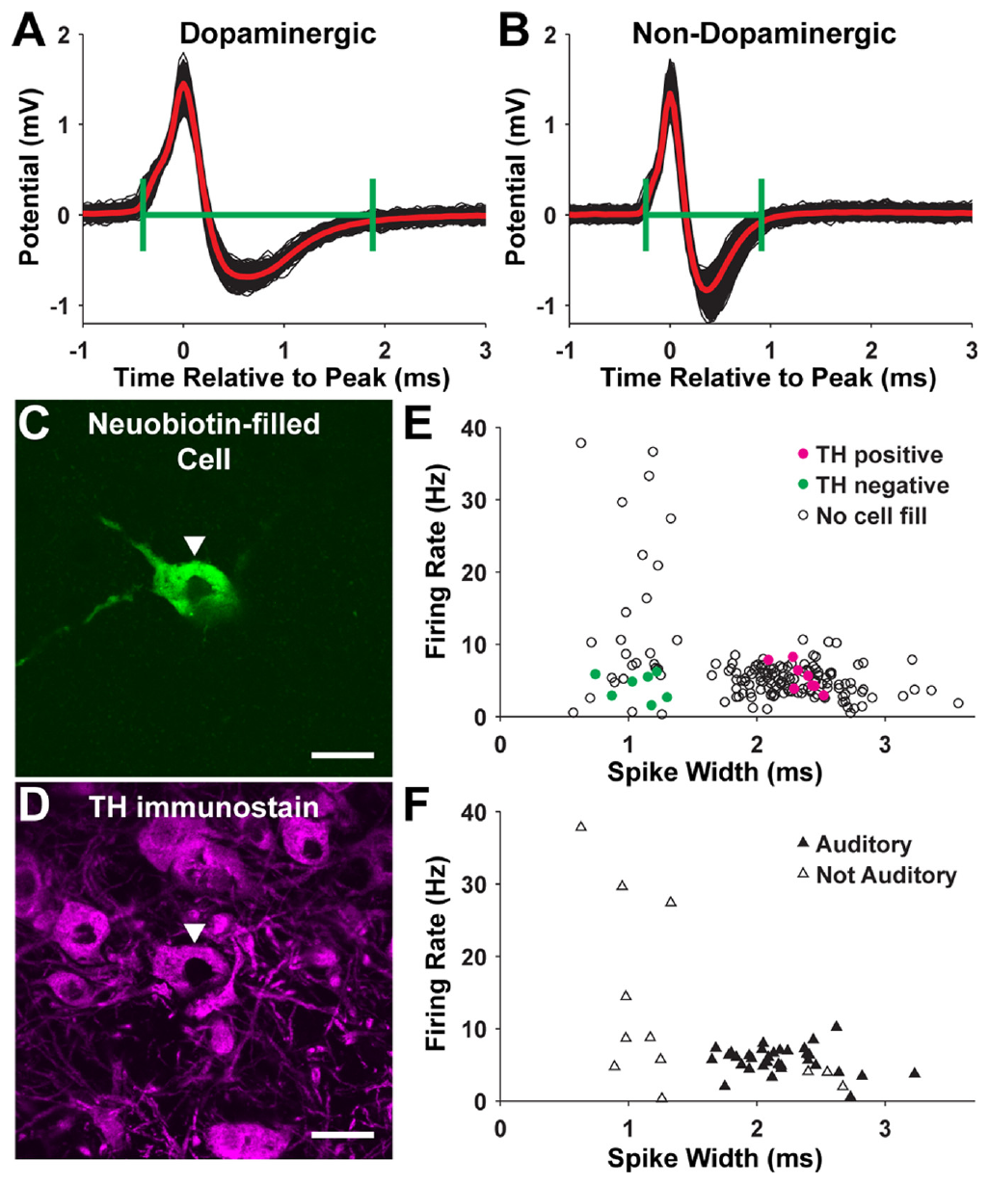
Cell labeling identifies dopaminergic midbrain neurons
Gale and Perkel recorded neurons in the substantia nigra pars compacta and ventral tegmental area, SNc/VTA, while testing auditory responses. These midbrain regions provide dopaminergic input to Area X, but recording location alone does not establish a neuron's transmitter identity.
They combined spike measurements with juxtacellular labeling and immunostaining for tyrosine hydroxylase, an enzyme involved in catecholamine synthesis. Labeled cells with the marker provided an anatomical and biochemical check on the classification based on firing properties.
The fluorescent micrographs retain 20 µm scale bars and connect a recorded cell with its tissue identity. Marker-positive cells support the dopaminergic interpretation in this preparation, but a waveform criterion alone remains less specific than identifying the recorded neuron histologically.
Gale & Perkel (2010a), Fig. 4(A–F). Recorded cell labeling and transmitter-marker staining.
Gale & Perkel (2010a), Fig. 1(A). Area X, DLM, LMAN, and midbrain connections.
Gale & Perkel (2010a)
44
Notes:
• Gale and Perkel recorded neurons in the substantia nigra pars compacta and ventral tegmental area, SNc/VTA, while testing auditory responses. These midbrain regions provide dopaminergic input to Area X, but recording location alone does not establish a neuron's transmitter identity.
• They combined spike measurements with juxtacellular labeling and immunostaining for tyrosine hydroxylase, an enzyme involved in catecholamine synthesis. Labeled cells with the marker provided an anatomical and biochemical check on the classification based on firing properties.
• The fluorescent micrographs retain 20 µm scale bars and connect a recorded cell with its tissue identity. Marker-positive cells support the dopaminergic interpretation in this preparation, but a waveform criterion alone remains less specific than identifying the recorded neuron histologically.
References:
Gale SD, Perkel DJ (2010a). A Basal Ganglia Pathway Drives Selective Auditory Responses in Songbird Dopaminergic Neurons via Disinhibition. The Journal of Neuroscience 30(3):1027-1037. https://doi.org/10.1523/jneurosci.3585-09.2010
Figure: Gale & Perkel (2010a), Fig. 4(A–F). Recorded cell labeling and transmitter-marker staining.
Figure source: https://doi.org/10.1523/jneurosci.3585-09.2010
Figure: Gale & Perkel (2010a), Fig. 1(A). Area X, DLM, LMAN, and midbrain connections.
Figure source: https://doi.org/10.1523/jneurosci.3585-09.2010

Slide 45
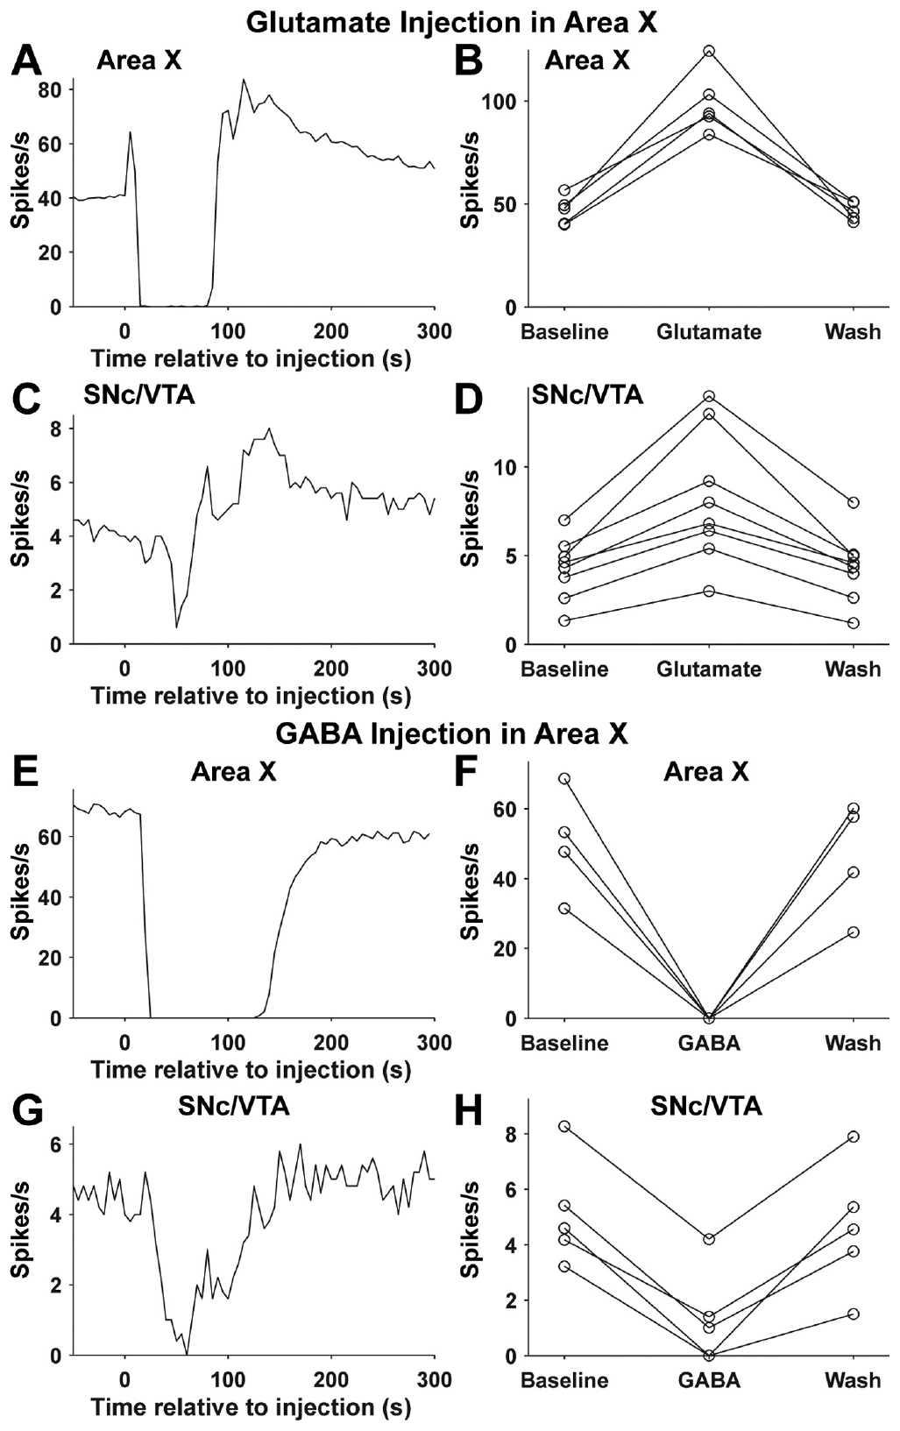
Area X activity can disinhibit dopaminergic neurons
Disinhibition is increased activity caused by reducing inhibitory input. Gale and Perkel found that song playback excited Area X neurons, inhibited neurons in the ventral pallidum, and excited identified dopaminergic SNc/VTA neurons, consistent with a serial inhibitory pathway.
Activating Area X with glutamate increased downstream dopaminergic firing, whereas GABA injection reduced it. Blocking AMPA and NMDA receptors in Area X diminished song-evoked dopaminergic responses; vehicle injections provided a control for the injection procedure.
The convergent recordings and interventions support a route through which song-related forebrain activity regulates its own dopamine supply. They do not establish that every evoked dopamine response encodes reward prediction or a vocal error; the experiments tested auditory responsiveness and circuit influence rather than a complete learning algorithm.
Gale & Perkel (2010a), Fig. 8(A–H). Area X drug injections alter midbrain firing.
Gale & Perkel (2010a), Fig. 1(A). Area X, DLM, LMAN, and midbrain connections.
Gale & Perkel (2010a)
45
Notes:
• Disinhibition is increased activity caused by reducing inhibitory input. Gale and Perkel found that song playback excited Area X neurons, inhibited neurons in the ventral pallidum, and excited identified dopaminergic SNc/VTA neurons, consistent with a serial inhibitory pathway.
• Activating Area X with glutamate increased downstream dopaminergic firing, whereas GABA injection reduced it. Blocking AMPA and NMDA receptors in Area X diminished song-evoked dopaminergic responses; vehicle injections provided a control for the injection procedure.
• The convergent recordings and interventions support a route through which song-related forebrain activity regulates its own dopamine supply. They do not establish that every evoked dopamine response encodes reward prediction or a vocal error; the experiments tested auditory responsiveness and circuit influence rather than a complete learning algorithm.
References:
Gale SD, Perkel DJ (2010a). A Basal Ganglia Pathway Drives Selective Auditory Responses in Songbird Dopaminergic Neurons via Disinhibition. The Journal of Neuroscience 30(3):1027-1037. https://doi.org/10.1523/jneurosci.3585-09.2010
Figure: Gale & Perkel (2010a), Fig. 8(A–H). Area X drug injections alter midbrain firing.
Figure source: https://doi.org/10.1523/jneurosci.3585-09.2010
Figure: Gale & Perkel (2010a), Fig. 1(A). Area X, DLM, LMAN, and midbrain connections.
Figure source: https://doi.org/10.1523/jneurosci.3585-09.2010

Slide 46
Key takeaways
Separate projection pathways HVC reaches RA directly for vocal motor control and reaches Area X through a distinct output population; DLM and LMAN form the anterior forebrain route back to RA.
Anatomical connections constrain mechanisms Lesions establish regional necessity, tracers establish projection direction, and single-cell reconstructions reveal local collaterals; none alone specifies the information transmitted at a synapse.
RA integrates different excitatory inputs HVC and LMAN converge on RA, but their developmental connectivity and receptor contributions differ; stronger, refined HVC input can coexist with persistent LMAN input.
Motor physiology has multiple controls Resurgent sodium current supports rapid RA firing, while SK channels regulate spike recovery and timing in interaction with synaptic input; dopamine modulates RA excitability through D1-like signaling.
LMAN contributes differently across ages Early lesions disrupt vocal development, whereas established adult song can persist after lesions; this difference does not imply that adult LMAN becomes anatomically disconnected or functionless.
Auditory selectivity is not an error signal by itself LMAN, Area X, and dopaminergic circuitry respond selectively to self-song, but anesthetized playback responses do not establish the complete teaching signal or learning rule used during singing.
Nottebohm et al. (1976); Bottjer et al. (1984); Doupe (1997)
46
Notes:
• Separate projection pathways. HVC reaches RA directly for vocal motor control and reaches Area X through a distinct output population; DLM and LMAN form the anterior forebrain route back to RA.
• Anatomical connections constrain mechanisms. Lesions establish regional necessity, tracers establish projection direction, and single-cell reconstructions reveal local collaterals; none alone specifies the information transmitted at a synapse.
• RA integrates different excitatory inputs. HVC and LMAN converge on RA, but their developmental connectivity and receptor contributions differ; stronger, refined HVC input can coexist with persistent LMAN input.
• Motor physiology has multiple controls. Resurgent sodium current supports rapid RA firing, while SK channels regulate spike recovery and timing in interaction with synaptic input; dopamine modulates RA excitability through D1-like signaling.
• LMAN contributes differently across ages. Early lesions disrupt vocal development, whereas established adult song can persist after lesions; this difference does not imply that adult LMAN becomes anatomically disconnected or functionless.
• Auditory selectivity is not an error signal by itself. LMAN, Area X, and dopaminergic circuitry respond selectively to self-song, but anesthetized playback responses do not establish the complete teaching signal or learning rule used during singing.
References:
Nottebohm F, Stokes TM, Leonard CM (1976). Central control of song in the canary, Serinus canarius. Journal of Comparative Neurology 165(4):457-486. https://doi.org/10.1002/cne.901650405
Bottjer SW, Miesner EA, Arnold AP (1984). Forebrain Lesions Disrupt Development But Not Maintenance of Song in Passerine Birds. Science 224(4651):901-903. https://doi.org/10.1126/science.6719123
Benezra SE, Narayanan RT, Egger R, Oberlaender M, Long MA (2018). Morphological characterization of HVC projection neurons in the zebra finch (Taeniopygia guttata). Journal of Comparative Neurology 526(10):1673-1689. https://doi.org/10.1002/cne.24437
Garst-Orozco J, Babadi B, Ölveczky BP (2014). A neural circuit mechanism for regulating vocal variability during song learning in zebra finches. eLife 3:e03697. https://doi.org/10.7554/elife.03697
Zemel BM, Nevue AA, Dagostin A, Lovell PV, Mello CV, von Gersdorff H (2021). Resurgent Na+ currents promote ultrafast spiking in projection neurons that drive fine motor control. Nature Communications 12(1):6762. https://doi.org/10.1038/s41467-021-26521-3
Hou GQ, Pan X, Liao CS, Wang SH, Li DF (2012). SK channels modulate the excitability and firing precision of projection neurons in the robust nucleus of the arcopallium in adult male zebra finches. Neuroscience Bulletin 28(3):271-281. https://doi.org/10.1007/s12264-012-1241-7
Liao C, Wang S, Pan X, Hou G, Li D (2013). Dopamine Modulates the Excitability of Projection Neurons in the Robust Nucleus of the Arcopallium in Adult Zebra Finches. PLoS ONE 8(12):e82497. https://doi.org/10.1371/journal.pone.0082497
Doupe AJ (1997). Song- and Order-Selective Neurons in the Songbird Anterior Forebrain and their Emergence during Vocal Development. The Journal of Neuroscience 17(3):1147-1167. https://doi.org/10.1523/jneurosci.17-03-01147.1997
Gale SD, Perkel DJ (2010a). A Basal Ganglia Pathway Drives Selective Auditory Responses in Songbird Dopaminergic Neurons via Disinhibition. The Journal of Neuroscience 30(3):1027-1037. https://doi.org/10.1523/jneurosci.3585-09.2010

