Slide 1
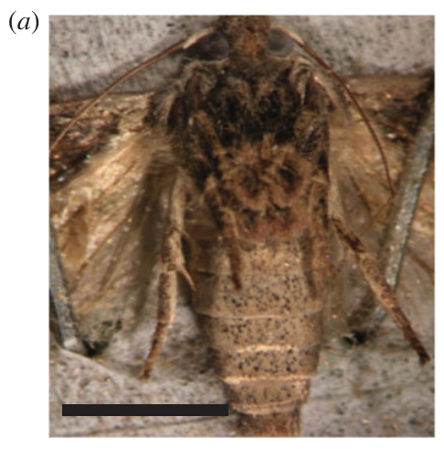
NEUR 411 · NEUROETHOLOGY · FALL 2026
Lecture 15
Insect hearing II:
moth ears and bat-evasion behavior (Roeder)
Monday, September 28, 2026
Jordan Lopez, Ph.D.
Professor of Neurobiology & Biomedical Engineering
Moir et al. (2013), Fig. 1(a). Greater wax moth; scale bar 5 mm.
Notes:
Insect hearing II: moth ears and bat-evasion behavior (Roeder)
Lecture 15. NEUR 411 · NEUROETHOLOGY · FALL 2026. Monday, September 28, 2026.
Figure: Moir et al. (2013), Fig. 1(a). Greater wax moth; scale bar 5 mm.
Figure source: https://doi.org/10.1098/rsbl.2013.0241
References:
Moir HM, Jackson JC, Windmill JFC (2013). Extremely high frequency sensitivity in a ‘simple’ ear. Biology Letters 9: 20130241. https://doi.org/10.1098/rsbl.2013.0241

Slide 2
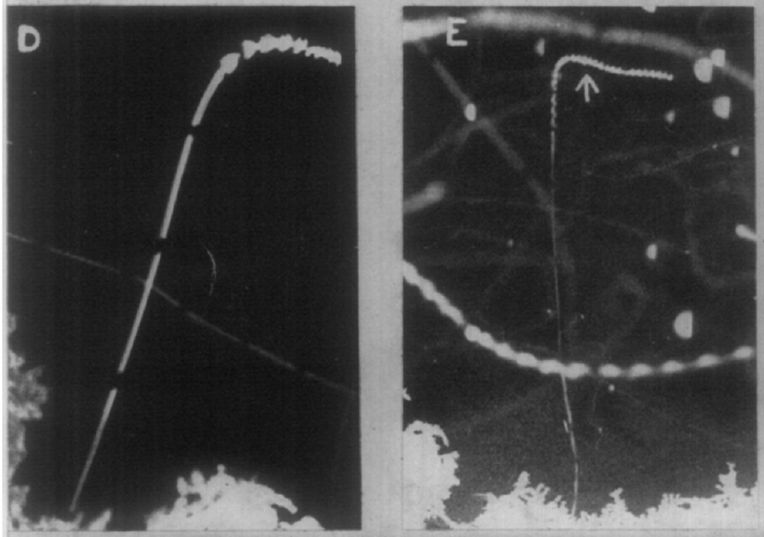
Ultrasound changes the flight of unrestrained moths
Free-flying moths changed course or stopped beating their wings when artificial ultrasound reached them. Ultrasound is sound above the range humans can hear. Roeder photographed these moths on an open lawn, so each insect flew without a wire or tether. Each insect appeared as its own photographic track, which kept every flight path separate.
A marker flash showed exactly when the sound started. Breaks in the photographic tracks marked a 0.25-second time base, so each reaction could be timed from onset. Trials with the flash alone caused no change in the flight path. That timing control distinguishes the sound's effect from the visible flash.
Some moths made passive dives with motionless wings. Others kept flying under their own power. Reaction times ranged from 0.2 seconds to more than one second after the sound began. The sound produced several flight responses rather than one fixed reflex. Bright illumination and mixed species were features of these field observations.
Roeder (1962), Fig. 1(D–E). Passive moth dives; gaps mark 0.25 s.
Roeder (1962)
02
Notes:
• Free-flying moths exposed to artificial **ultrasound**, sound above the human audible range, changed course or stopped beating their wings. Roeder photographed these responses on an open lawn rather than restricting the insects to a wire or tether.
• A marker flash identified stimulus onset, and interruptions in the photographic tracks provided a 0.25-s time base. Flash-only trials caused no flight deviation; enclosing the camera reduced unwanted ultrasound from its shutter.
– A stationary-flight preparation can constrain turning and may already disturb the animal. Roeder instead examined insects entering the sound field during their own flights. The timing control separates the effect of ultrasound from the visible flash used to mark its onset.
• Some moths made passive dives with motionless wings, whereas others continued powered flight. Recorded reaction times ranged from 0.2 s to more than 1 s. These field observations establish ultrasound-evoked flight changes, but bright illumination and incomplete species identification limit conclusions about natural darkness and species-specific responses.
References:
Roeder KD (1962). The behaviour of free flying moths in the presence of artificial ultrasonic pulses. Animal Behaviour 10: 300-304. https://doi.org/10.1016/0003-3472(62)90053-2
Figure: Roeder (1962), Fig. 1(D–E). Passive moth dives; gaps mark 0.25 s.
Figure source: https://doi.org/10.1016/0003-3472(62)90053-2

Slide 3
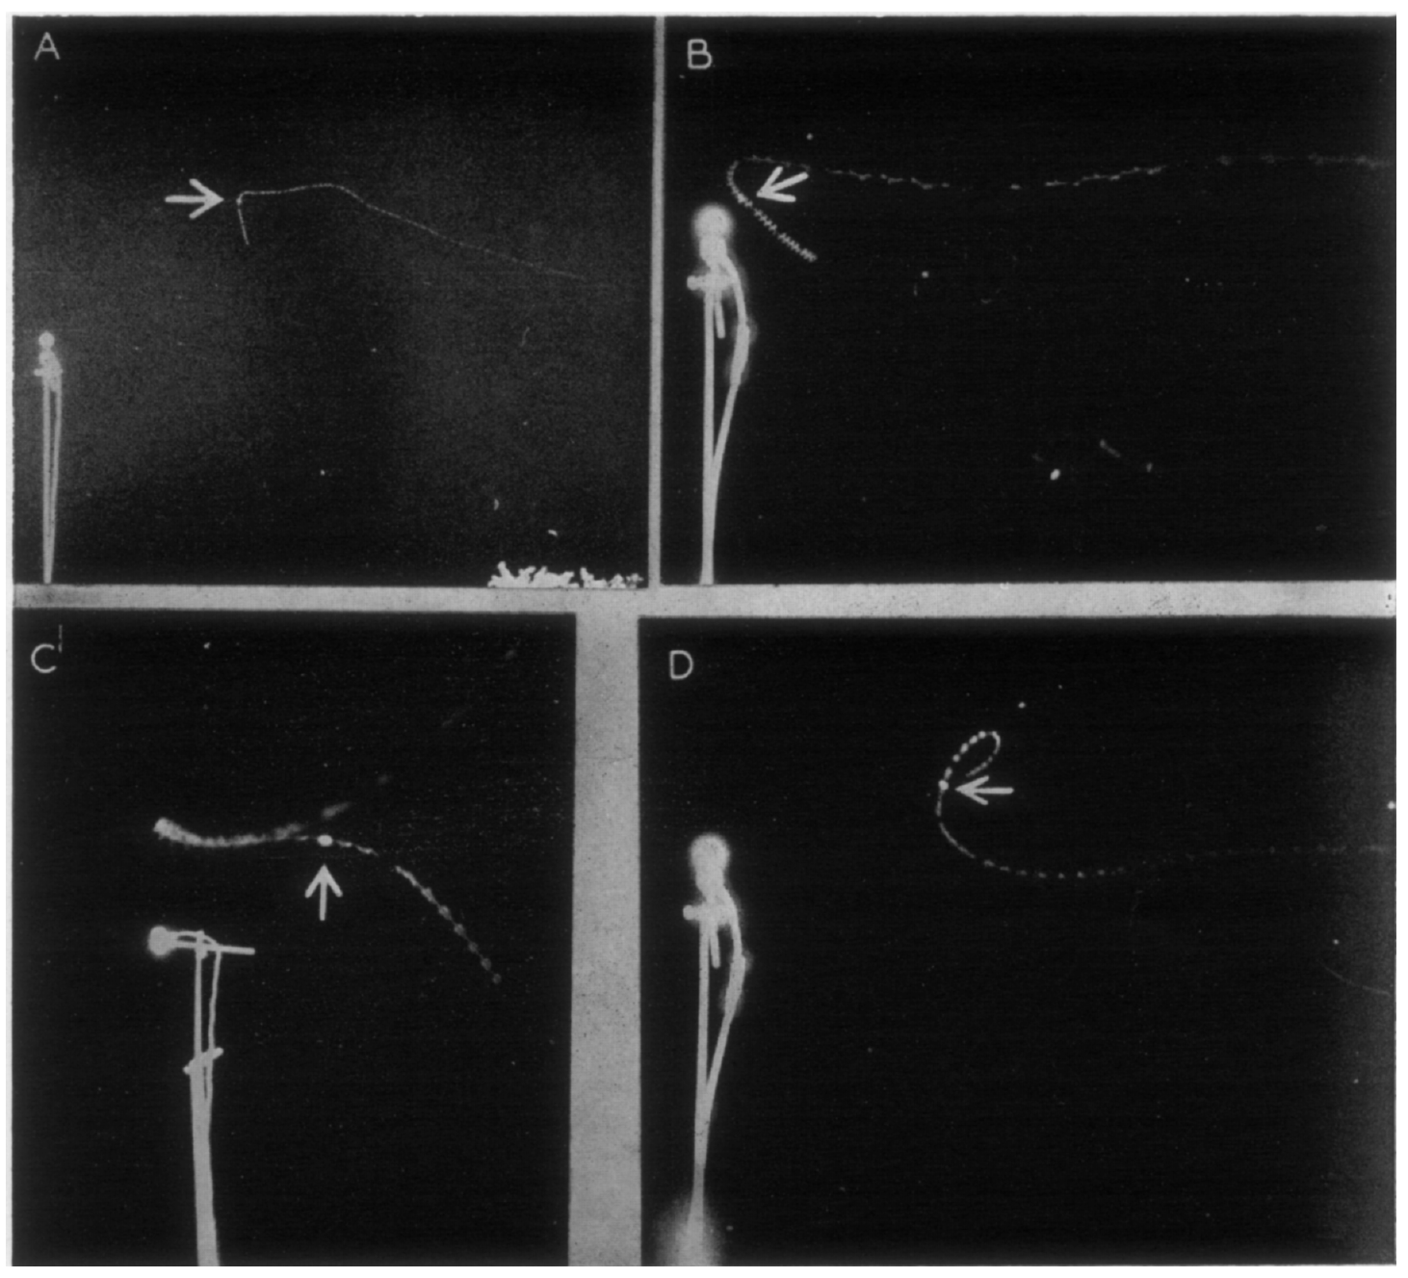
Weaker ultrasound elicits flight away from the source
At longer distances, or when the ultrasonic output fell, moths turned and flew away from the loudspeaker. The avoidance changed the direction of the flight path relative to the source, which mattered more than the change in height. Roeder recorded this response in moths that were free to fly. Direction referred to how the insect's path lay against the ultrasonic source.
The speaker stayed in one fixed position while naturally flying moths crossed an illuminated area. Moths that approached the source could reverse course. Insects below the source sometimes descended, and insects above it could turn upward. The lamp provided the light gradient that the moths crossed during each trial. Each moth's path was judged against that single fixed position.
Moths turned away whether the new path carried them toward, away from or across the light gradient. Light position alone did not decide the turn. The turns show that sound helped set the direction of flight. Those turns happened across all three path types, including paths that crossed the gradient.
Roeder (1962), Fig. 2(A–D). Flight turns away from the sound source.
Roeder (1962)
03
Notes:
• At greater distances from the source, or after the ultrasonic output was reduced, moths turned and flew away from the loudspeaker. This **directional avoidance** changed the flight path relative to the source, rather than simply reducing altitude.
• The source position was fixed while naturally flying moths crossed the illuminated area. Moths approaching the source could reverse their course; those below it sometimes descended, and those above it could turn upward.
– Direction refers to the relationship between the insect’s path and the ultrasonic source. A downward movement can be directional when it carries the moth away from a source above it. A dive alone therefore does not determine whether directional information influenced the response.
• Turning away occurred whether the resulting path carried an insect toward, away from, or across the light gradient. The comparison supports an acoustic contribution to direction. It does not identify the central comparator that converts differences between the two ears into asymmetric wing movements.
References:
Roeder KD (1962). The behaviour of free flying moths in the presence of artificial ultrasonic pulses. Animal Behaviour 10: 300-304. https://doi.org/10.1016/0003-3472(62)90053-2
Figure: Roeder (1962), Fig. 2(A–D). Flight turns away from the sound source.
Figure source: https://doi.org/10.1016/0003-3472(62)90053-2

Slide 4
Direction is judged from the moth's path
A downward movement can count as directional when it carries the moth away from a source above it. A dive can carry a moth away from an overhead speaker, so the path, not the dive, marks direction. Roeder's photographs made each insect's path visible for that judgment. Roeder applied that path-based definition throughout the trials.
Roeder enclosed the camera, which reduced the unwanted ultrasound produced by its shutter. The enclosure removed an artifact that the camera itself introduced. Stationary-flight preparations can restrict turning and may disturb the animal before a test. Roeder instead watched insects that entered the sound field during their own flights. Each trial was judged by the moth's path after onset.
Pooling different maneuvers into one rigid reflex would discard the variation recorded in free flight. Roeder's records keep turning, diving and climbing as separate responses to the same sound. Each response is a different motor solution to the acoustic threat. The records cover responses from weaker and stronger sources. Those responses were measured in natural flight.
Roeder (1962), Fig. 2(A–D). Flight turns away from the sound source.
Roeder (1962)
03a
Notes:
• Direction is judged from the moth's path.
• Explanation 1.
– A downward movement can count as directional when it carries the moth away from a source above it
– A dive can carry a moth away from an overhead speaker, so the path, not the dive, marks direction. Roeder's photographs made each insect's path visible for that judgment. Roeder applied that path-based definition throughout the trials.
• Explanation 2.
– Roeder enclosed the camera, which reduced the unwanted ultrasound produced by its shutter
– The enclosure removed an artifact that the camera itself introduced. Stationary-flight preparations can restrict turning and may disturb the animal before a test. Roeder instead watched insects that entered the sound field during their own flights. Each trial was judged by the moth's path after onset.
• Explanation 3.
– Pooling different maneuvers into one rigid reflex would discard the variation recorded in free flight
– Roeder's records keep turning, diving and climbing as separate responses to the same sound. Each response is a different motor solution to the acoustic threat. The records cover responses from weaker and stronger sources. Those responses were measured in natural flight.
• Source.
– The figure and the measurements come from Roeder (1962).
– Each statement above comes from that paper's text, its figure legend or the speaker notes.
References:
Roeder KD (1962). The behaviour of free flying moths in the presence of artificial ultrasonic pulses. Animal Behaviour 10: 300-304. https://doi.org/10.1016/0003-3472(62)90053-2

Slide 5
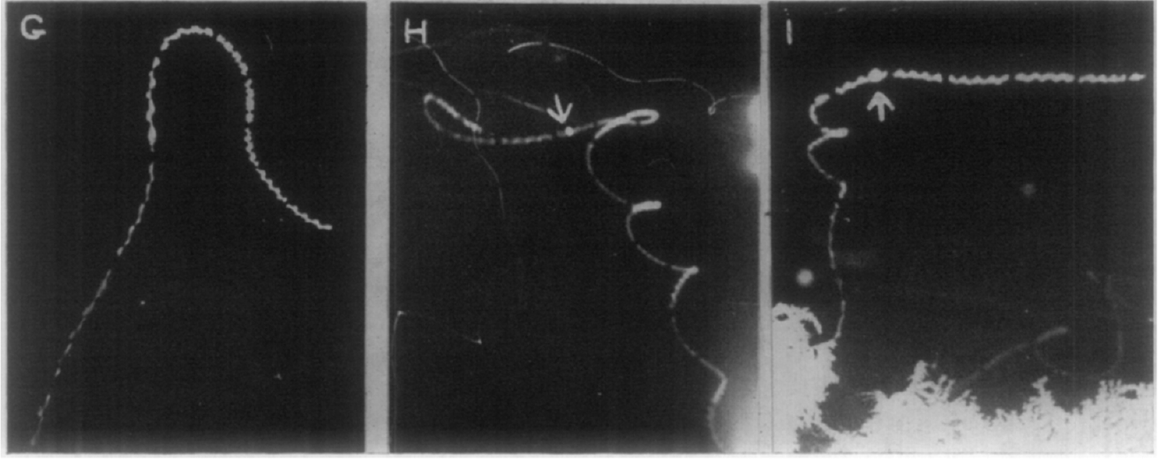
Stronger stimulation recruits varied diving maneuvers
Moths closer to the transducer performed a range of escape maneuvers. These included sharp passive dives, powered dives, loops, tight turns and climbs followed by descents. Most of these movements carried the moths toward the ground. The moths did not all head in one uniform direction away from the source. Each maneuver was judged from the photographed flight path.
Roeder usually repeated ultrasonic pulses 30 times per second. The sound continued while the flight was photographed. That design allowed observers to separate the path after sound onset from the movement the moth had already started. Each maneuver was recorded in free flight rather than on a restraining wire. The trajectory after onset could be read directly from the photographs.
Wing movements could stop or speed up after stimulation. A climb before a dive and continued wingbeats during a turn were different responses to one stimulus. The records show weaker sources producing avoidance and stronger sources producing diving. Stronger stimulation changed the form of the response, not only its direction.
Roeder (1962), Fig. 1(G–I). Climb–dive and turning responses.
Roeder (1962)
04
Notes:
• Moths closer to the transducer exhibited a range of escape maneuvers: sharp passive dives, powered dives, loops, tight turns, and climbs followed by descents. Their common tendency was movement toward the ground, rather than a uniform direction away from the source.
• Roeder usually repeated ultrasonic pulses 30 times per second. The stimulus continued while flight was photographed, allowing the trajectory after sound onset to be distinguished from the insect’s preceding movement.
– The climb preceding a dive and the continuing wingbeats during a turn are different motor solutions to an acoustic threat. Pooling them into one rigid reflex would discard the actual variation recorded in free flight. Bright lighting remains an experimental limitation even for moths without overt attraction to the lamp.
• Wing movements could cease or increase in frequency after stimulation. The behavioral distinction between weaker-source avoidance and stronger-source diving is supported by these records. A simple assignment of each maneuver to one receptor cell is not established, because the experiment did not selectively manipulate auditory neurons or reliably identify every responding species.
References:
Roeder KD (1962). The behaviour of free flying moths in the presence of artificial ultrasonic pulses. Animal Behaviour 10: 300-304. https://doi.org/10.1016/0003-3472(62)90053-2
Figure: Roeder (1962), Fig. 1(G–I). Climb–dive and turning responses.
Figure source: https://doi.org/10.1016/0003-3472(62)90053-2

Slide 6
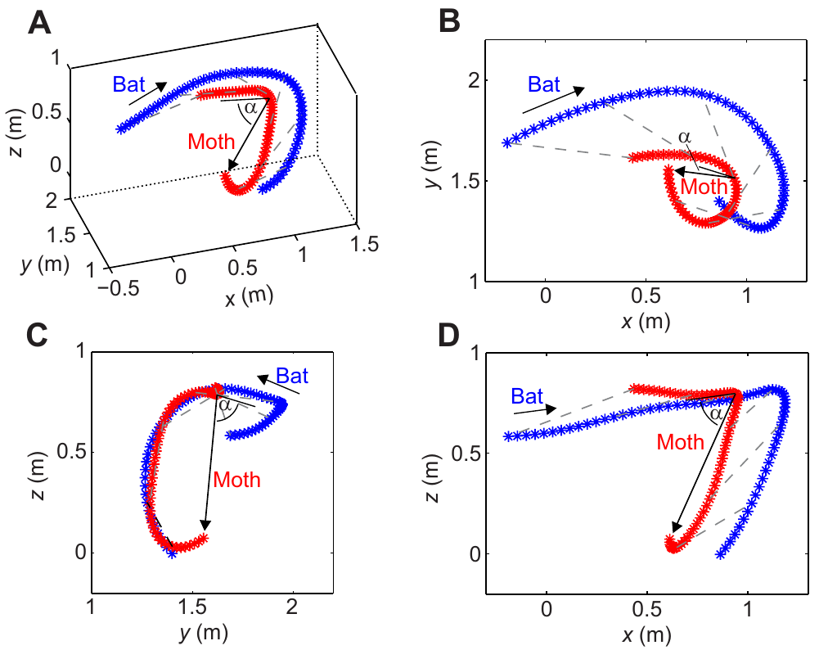
Three-dimensional tracking measures actual bat attacks
Corcoran and Conner recorded long-legged myotis bats, Myotis volans, chasing naturally flying moths in an outdoor enclosure. Infrared cameras tracked predator and prey positions. The bats pursued moths that flew freely in the enclosure. This setup avoided the visible floodlighting that Roeder's photographic method required. The enclosure was outdoors, so the bats hunted under natural conditions.
Synchronized camera views were combined into three-dimensional trajectories. The enclosure measured 6 by 4 meters and stood 2.2 to 3 meters high. Calibration assigns a common spatial coordinate system to the camera recordings. Each reconstructed path was matched to the outcome of its encounter, whether the moth escaped or was captured. Released moths were allowed to fly naturally before attacks were analyzed.
A turn seen from one camera can hide changes in altitude or depth. Reconstructed paths measure those components directly. They also give speed and turning performance for each moth. The paths show how each moth moved in space relative to the bat. The measured paths are trajectories through a volume, not drawings inferred from one photograph.
Corcoran & Conner (2016), Fig. 3(A–D). Measured three-dimensional evasive flight trajectories.
Corcoran & Conner (2016)
05
Notes:
• Corcoran and Conner recorded long-legged myotis bats, _Myotis volans_, pursuing naturally flying moths in an outdoor enclosure. Infrared cameras registered predator and prey positions without the visible floodlighting required by Roeder’s photographic method.
• The enclosure measured 6 m by 4 m, with a height of 2.2–3 m. Synchronized camera views were calibrated and reconstructed into three-dimensional trajectories, linking movements in space to the outcome of each encounter.
– Calibration assigns a common spatial coordinate system to the camera recordings. The measured paths are therefore trajectories through a volume, rather than drawings inferred from a single photograph. Released moths were allowed to fly naturally before attacks were analyzed.
• A turn observed from one camera can conceal changes in altitude or depth. Reconstructed trajectories resolve those components and permit measurements of speed and turning performance. The encounters reveal real pursuit and evasion, but the enclosure and available moth assemblage constrain generalization to every hunting habitat and predator species.
References:
Corcoran AJ, Conner WE (2016). How moths escape bats: predicting outcomes of predator-prey interactions. Journal of Experimental Biology 219: 2704–2715. https://doi.org/10.1242/jeb.137638
Figure: Corcoran & Conner (2016), Fig. 3(A–D). Measured three-dimensional evasive flight trajectories.
Figure source: https://doi.org/10.1242/jeb.137638

Slide 7
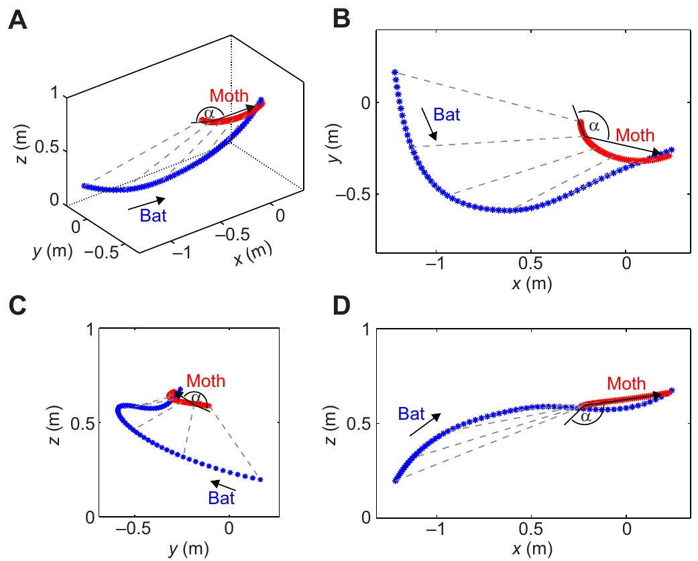
Evasion greatly reduces capture during aerial pursuit
In the observed encounters, bats captured 37.5 percent of evasive prey and 98 percent of non-evasive prey. A moth counted as evasive when it made sharp turns or accelerations during the attack. Survival in this setting depended heavily on that maneuver. An evasive moth could still be captured, so the outcome and the maneuver were recorded separately.
Infrared video matched each movement sequence to capture or escape. Non-evasive moths followed slow or broad paths. Evasive moths changed speed or direction abruptly as the bat approached. Each movement sequence was recorded from the approach through to the capture or escape. The timing of each abrupt change was logged against the bat's position.
The authors measured kinematics to explain why some evasive paths succeeded and others failed. Kinematics here means the speed, turning and acceleration of each path. These measurements compare the maneuvers that escaped with those that were caught. Survival alone says little about the maneuver, so the measured paths carry the explanation.
Corcoran & Conner (2016), Fig. 4(A–D). Measured capture of a non-evasive moth.
Corcoran & Conner (2016), Fig. 3(A–D). Measured three-dimensional evasive flight trajectories.
Corcoran & Conner (2016)
06
Notes:
• In the observed bat–moth encounters, bats captured 37.5% of evasive prey but 98% of non-evasive prey. Evasion was identified by sharp turns or accelerations during the attack, rather than by labeling every surviving moth as evasive.
• Infrared video linked each movement sequence to capture or escape. Non-evasive moths followed comparatively slow or broad paths, whereas evasive moths changed speed or direction abruptly as the bat approached.
– The distinction between movement and outcome prevents a circular definition of escape behavior. An evasive moth can still be captured, and survival alone does not specify the maneuver. The authors measured kinematics to examine why some evasive paths succeeded while others did not.
• The comparison connects flight behavior with survival in this preparation. It does not prove that every difference arose from hearing alone: moth species, body form and flight performance also differed. Successful evasion therefore requires analysis of the actual maneuver as well as the sensory signal that may have initiated it.
References:
Corcoran AJ, Conner WE (2016). How moths escape bats: predicting outcomes of predator-prey interactions. Journal of Experimental Biology 219: 2704–2715. https://doi.org/10.1242/jeb.137638
Figure: Corcoran & Conner (2016), Fig. 4(A–D). Measured capture of a non-evasive moth.
Figure source: https://doi.org/10.1242/jeb.137638
Figure: Corcoran & Conner (2016), Fig. 3(A–D). Measured three-dimensional evasive flight trajectories.
Figure source: https://doi.org/10.1242/jeb.137638

Slide 8
Evasion was scored from the flight itself
Evasion was scored from the flight itself. A moth could be evasive and still be captured. Keeping movement and outcome apart prevents a circular definition of escape behavior. Surviving the encounter tells nothing about the maneuver itself. The authors recorded capture or escape for every encounter. The authors used infrared video to record each sequence.
Moth species, body form and flight performance also differed between the evasive and non-evasive groups. Those traits could also affect capture, alongside the maneuvers themselves. Successful evasion needs analysis of the maneuver itself, not just the sensory signal behind it. Flight performance was measured from the same reconstructed paths.
The study covered real pursuit and evasion in one outdoor enclosure. The moth assemblage in that enclosure limits how far the results extend to other habitats and predator species. A different set of moths would test that boundary. Each encounter was scored from the recorded path and its outcome. The results apply to this enclosure.
Corcoran & Conner (2016), Fig. 4(A–D). Measured capture of a non-evasive moth.
Corcoran & Conner (2016), Fig. 3(A–D). Measured three-dimensional evasive flight trajectories.
Corcoran & Conner (2016)
06a
Notes:
• Evasion was scored from the flight itself.
• Explanation 1.
– Evasion was scored from the flight itself
– A moth could be evasive and still be captured. Keeping movement and outcome apart prevents a circular definition of escape behavior. Surviving the encounter tells nothing about the maneuver itself. The authors recorded capture or escape for every encounter. The authors used infrared video to record each sequence.
• Explanation 2.
– Moth species, body form and flight performance also differed between the evasive and non-evasive groups
– Those traits could also affect capture, alongside the maneuvers themselves. Successful evasion needs analysis of the maneuver itself, not just the sensory signal behind it. Flight performance was measured from the same reconstructed paths.
• Explanation 3.
– The study covered real pursuit and evasion in one outdoor enclosure
– The moth assemblage in that enclosure limits how far the results extend to other habitats and predator species. A different set of moths would test that boundary. Each encounter was scored from the recorded path and its outcome. The results apply to this enclosure.
• Source.
– The figure and the measurements come from Corcoran & Conner (2016).
– Each statement above comes from that paper's text, its figure legend or the speaker notes.
References:
Corcoran AJ, Conner WE (2016). How moths escape bats: predicting outcomes of predator-prey interactions. Journal of Experimental Biology 219: 2704–2715. https://doi.org/10.1242/jeb.137638

Slide 9
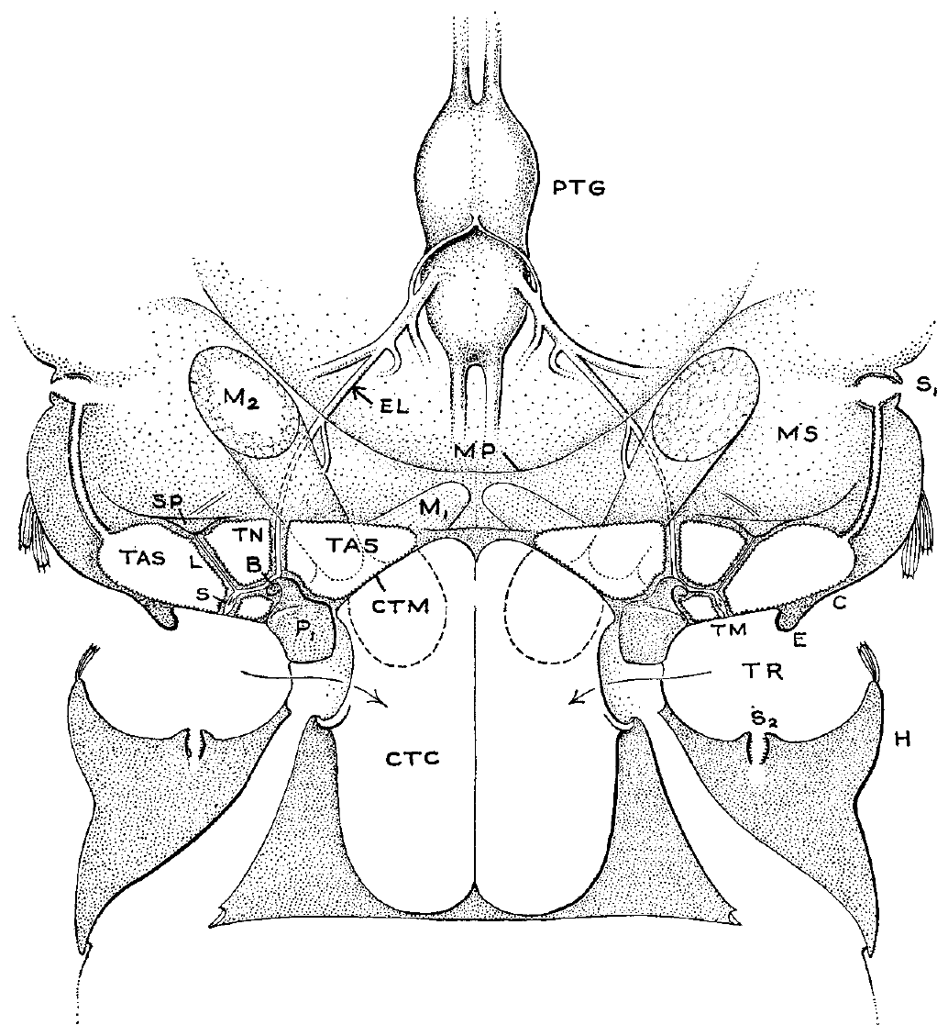
Noctuid ears connect the tympanum to sensory neurons
A tympanum is a thin membrane that vibrates in response to airborne sound. In noctuid moths it sits in a recessed region of the posterior thorax, close to the junction between thorax and abdomen. Sound moves this membrane first, which is the mechanical start of hearing. The thorax holds the membrane within a recessed pocket.
Roeder and Treat described a sensory attachment on the membrane's inner surface, enclosed within the tympanic air sac. The tympanic nerve runs from this apparatus toward the thoracic ganglion. Sensory axons in that nerve carry the signal into the central nervous system. The published reconstruction is anatomy, not a measure of vibration.
Sound must first move the membrane, and the attached receptors must then convert that movement into neural activity. This anatomy gives sound a mechanical route to sensory tissue. The published reconstruction names supporting structures, while separate nerve experiments test what the anatomy does. The nerve experiments measured spikes that travel from the ear toward the ganglion.
Roeder & Treat (1957), Fig. 1. Published noctuid ear, nerve and ganglion anatomy.
Roeder & Treat (1957)
07
Notes:
• A **tympanum** is a thin membrane that vibrates in response to airborne sound. In noctuid moths it occupies a recessed region of the posterior thorax, near the junction between thorax and abdomen.
• Roeder and Treat described a sensory attachment on the membrane’s inner surface, enclosed within the tympanic air sac. The **tympanic nerve**, a bundle carrying sensory axons, runs from this apparatus toward the thoracic ganglion.
– The membrane, sensory attachment and nerve are distinct components. Sound must first move the membrane; the attached receptors must then convert that movement into neural activity. A visible anatomical connection does not by itself specify either the mechanical sensitivity or the neural threshold.
• This anatomy provides a mechanical route from external sound to sensory tissue and a neural route into the central nervous system. The published anatomical reconstruction identifies named supporting structures, but it is not a measurement of vibration or a complete synaptic map. Its functional interpretation depends on the separate nerve-recording experiments.
References:
Roeder KD, Treat AE (1957). Ultrasonic reception by the tympanic organ of noctuid moths. Journal of Experimental Zoology 134: 127-157. https://doi.org/10.1002/jez.1401340107
Figure: Roeder & Treat (1957), Fig. 1. Published noctuid ear, nerve and ganglion anatomy.
Figure source: https://doi.org/10.1002/jez.1401340107

Slide 10
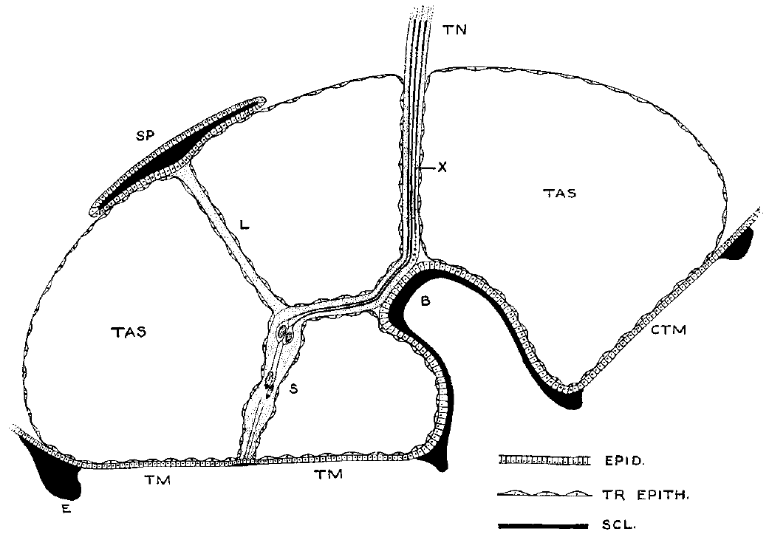
Sensory attachments couple membrane motion to the ear
The noctuid tympanic sensory organ holds two scolopes, specialized supporting elements. A scolops belongs to the supporting receptor apparatus, not to a separate central neuron. Sensory-cell dendrites sit beside them. A dendrite is the peripheral part of a sensory neuron that receives the mechanical stimulus. Its axon carries the resulting signal centrally.
The sensory attachment extends inward from the tympanic membrane. A ligament and surrounding tissues hold it in place. Roeder and Treat's published section marks some cell details as presumptive. The authors warned that cap cells, accessory cells and surrounding epithelium complicate the microscopic picture. The section keeps those qualifications attached to the anatomy.
Two acoustic response units appeared later in the nerve recordings. Anatomy and nerve recordings agree on a small receptor population of two cells. Mechanically gated ion channels and the force on each dendrite are questions for other measurements. The section records structure, not those forces. The anatomy and the physiology agree, which strengthens the small-population picture.
Roeder & Treat (1957), Fig. 2. Published section through the ear and sensory attachment.
Roeder & Treat (1957)
08
Notes:
• The noctuid tympanic sensory organ contains two **scolopes**, specialized supporting elements associated with sensory-cell dendrites. A dendrite is the peripheral region of a sensory neuron that receives the mechanical stimulus, whereas its axon carries the resulting signal centrally.
• The sensory attachment extends inward from the tympanic membrane and is supported by a ligament and surrounding tissues. Roeder and Treat’s published section represents these relationships while explicitly leaving some cellular details presumptive.
– A scolops belongs to the supporting receptor apparatus rather than serving as a separate central neuron. The authors warned that cap cells, accessory cells and surrounding epithelium complicate the microscopic picture. The reconstruction should therefore be treated as published anatomy with its original qualifications intact.
• Two acoustic response units were subsequently distinguished in the nerve recordings. Agreement between anatomy and physiology supports a small receptor population, but the section does not identify a mechanically gated ion channel or prove the exact force experienced by each dendrite. Those molecular and mechanical questions require different measurements.
References:
Roeder KD, Treat AE (1957). Ultrasonic reception by the tympanic organ of noctuid moths. Journal of Experimental Zoology 134: 127-157. https://doi.org/10.1002/jez.1401340107
Figure: Roeder & Treat (1957), Fig. 2. Published section through the ear and sensory attachment.
Figure source: https://doi.org/10.1002/jez.1401340107

Slide 11
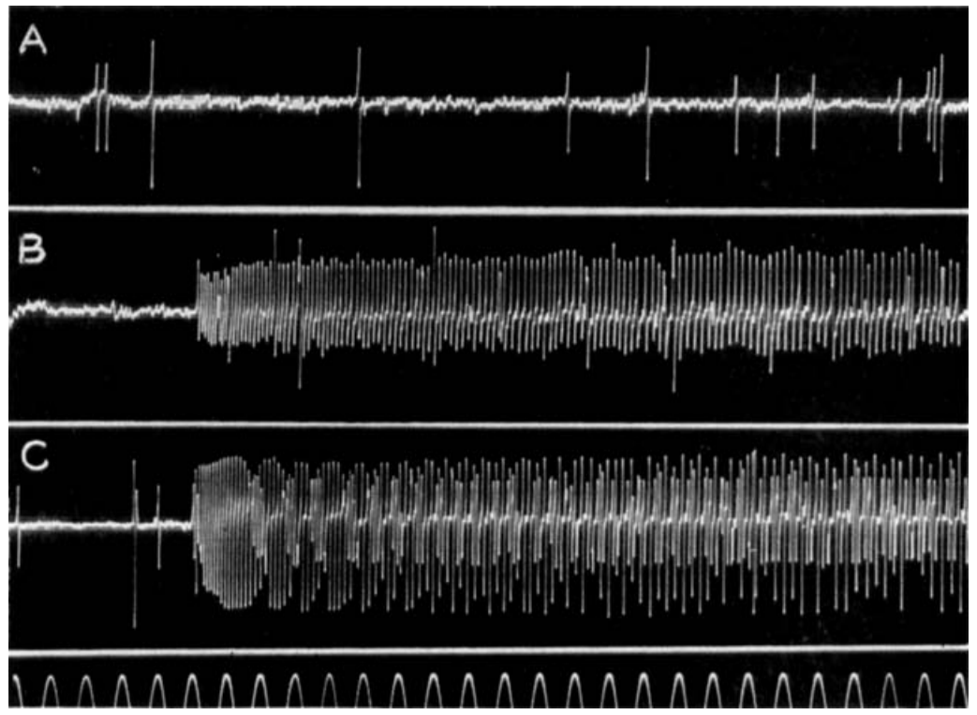
Sound recruits acoustic units within the tympanic nerve
An afferent is a neuron that carries information from a sensory organ toward the central nervous system. Roeder and Treat recorded afferent spikes from the tympanic nerve with an extracellular electrode. Sound-evoked trains were recorded as they left the sensory organ. The electrode records voltage changes outside the axon, so electrode geometry partly sets the size of each spike.
The electrode detects voltage changes from nearby action potentials, the brief electrical impulses that travel along axons. Sound produced rapid spike trains in two acoustic units. A larger unit fired on its own regular schedule and ignored the sound entirely. Sound-evoked trains followed the pulses, while the regular unit did not change.
Different acoustic thresholds separate receptor units, even when their spike sizes overlap. The sound-driven spikes give the most reliable label for each unit. Spike amplitude alone identifies a cell poorly, because overlapping sizes blur the difference between units. The two units match the two sensory cells in the published section.
Roeder & Treat (1957), Fig. 3(A–C). Spontaneous and sound-evoked nerve activity.
Roeder & Treat (1957), Fig. 2. Published section through the ear and sensory attachment.
Roeder & Treat (1957)
09
Notes:
• An **afferent** is a neuron carrying information from a sensory organ toward the central nervous system. Roeder and Treat recorded afferent spikes extracellularly from the tympanic nerve after separating it from central connections.
• An extracellular electrode detects voltage changes produced by nearby action potentials, the brief electrical impulses propagated along axons. Sound produced rapid trains in two acoustic units; a larger, regularly recurring non-acoustic unit remained insensitive to the stimulus.
– The electrical signal is measured outside the axon, so its size depends partly on electrode geometry. The nerve was disconnected from the central ganglion in the original preparation. Sound-evoked activity therefore originated peripherally rather than requiring a feedback command from the brain.
• The non-acoustic discharge commonly occurred at 5–20 spikes per second. Separating this activity from sound-evoked spikes prevents every nerve event from being counted as hearing. Different acoustic thresholds distinguish receptor units even when their recorded spike sizes overlap; recording amplitude alone is an unreliable cell label.
References:
Roeder KD, Treat AE (1957). Ultrasonic reception by the tympanic organ of noctuid moths. Journal of Experimental Zoology 134: 127-157. https://doi.org/10.1002/jez.1401340107
Figure: Roeder & Treat (1957), Fig. 3(A–C). Spontaneous and sound-evoked nerve activity.
Figure source: https://doi.org/10.1002/jez.1401340107
Figure: Roeder & Treat (1957), Fig. 2. Published section through the ear and sensory attachment.
Figure source: https://doi.org/10.1002/jez.1401340107

Slide 12
Sound-driven spikes mark peripheral input
The nerve had been separated from the central ganglion in the original preparation. Sound-evoked activity arose in the periphery, not from a feedback command sent by the brain. That separation kept central input out of the recording. The sensory side alone was sampled. The preparation kept the nerve's sensory output intact.
The non-acoustic discharge commonly occurred at 5 to 20 spikes per second. Separating that activity from sound-evoked spikes keeps every nerve event from counting as hearing. The regular firing of that unit gave a clear baseline for the sound-driven trains. Only two acoustic units followed the sound in these recordings.
Two acoustic units responded to sound, and the regular unit did not. Their thresholds separated the two responding units in the same nerve. The recorded thresholds identify the cells, not the spike forms. Roeder and Treat recorded both kinds of unit in the same preparation. Their thresholds were distinct even where spike sizes overlapped.
Roeder & Treat (1957), Fig. 3(A–C). Spontaneous and sound-evoked nerve activity.
Roeder & Treat (1957), Fig. 2. Published section through the ear and sensory attachment.
Roeder & Treat (1957)
09a
Notes:
• Sound-driven spikes mark peripheral input.
• Explanation 1.
– The nerve had been separated from the central ganglion in the original preparation
– Sound-evoked activity arose in the periphery, not from a feedback command sent by the brain. That separation kept central input out of the recording. The sensory side alone was sampled. The preparation kept the nerve's sensory output intact.
• Explanation 2.
– The non-acoustic discharge commonly occurred at 5 to 20 spikes per second
– Separating that activity from sound-evoked spikes keeps every nerve event from counting as hearing. The regular firing of that unit gave a clear baseline for the sound-driven trains. Only two acoustic units followed the sound in these recordings.
• Explanation 3.
– Two acoustic units responded to sound, and the regular unit did not
– Their thresholds separated the two responding units in the same nerve. The recorded thresholds identify the cells, not the spike forms. Roeder and Treat recorded both kinds of unit in the same preparation. Their thresholds were distinct even where spike sizes overlapped.
• Source.
– The figure and the measurements come from Roeder & Treat (1957).
– Each statement above comes from that paper's text, its figure legend or the speaker notes.
References:
Roeder KD, Treat AE (1957). Ultrasonic reception by the tympanic organ of noctuid moths. Journal of Experimental Zoology 134: 127-157. https://doi.org/10.1002/jez.1401340107

Slide 13
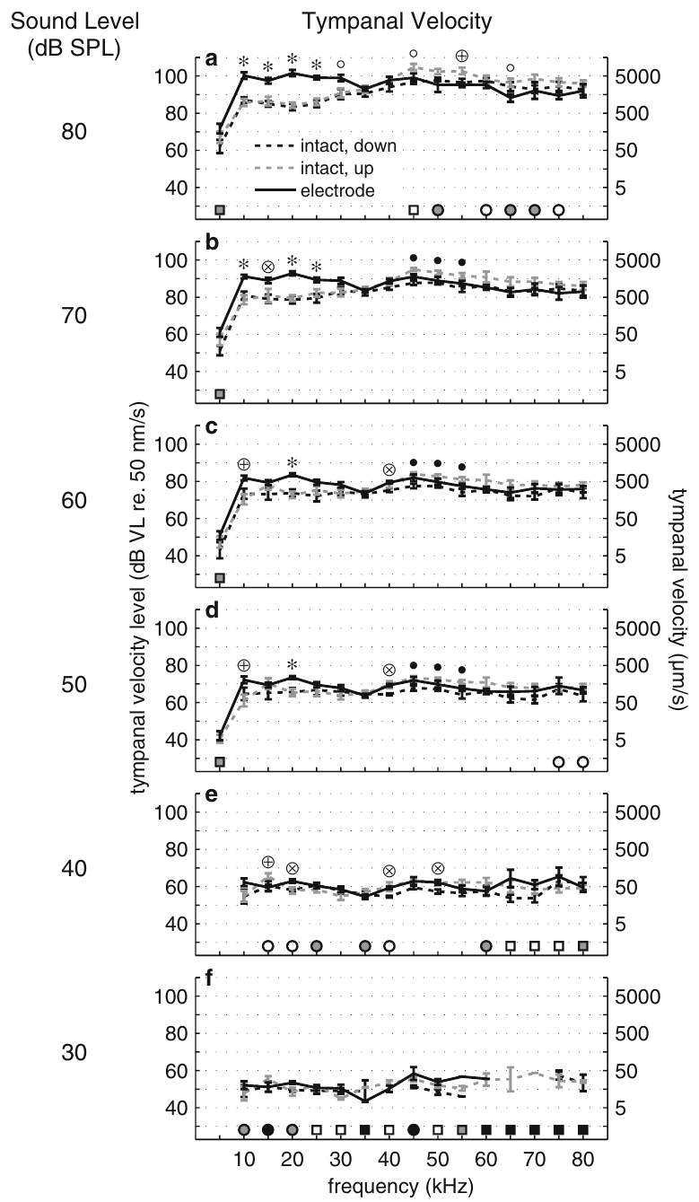
Vibrometry links membrane motion to neural activity
Laser Doppler vibrometry measures surface motion from changes in reflected laser light. In Noctua pronuba, ter Hofstede and colleagues aimed the laser at the tympanum's sensory-cell attachment while presenting calibrated sound pulses. The attachment is the receptor's mechanical site. The laser pointed at that site rather than at a point that was easiest to illuminate.
The method recorded velocity, the speed of membrane motion, and displacement, its distance from the resting position. Stimuli lasted 20 ms and covered 5 to 80 kHz. The incident sound was measured beside the ear. The speaker stood 30 cm from the preparation, and the microphone sat about 2 mm from the ear.
Auditory-nerve recordings ran at the same time, so each mechanical response could be matched to its spikes. Measuring the attachment itself targets the input that drives the receptor cells. Local measurement matters because the animal and recording equipment can change the sound field. The mechanical data were tied to spike output in the same animals.
Roeder & Treat (1957), Fig. 2. Published section through the ear and sensory attachment.
ter Hofstede et al. (2011), Fig. 1(a–f). Membrane velocity in intact and dissected preparations.
ter Hofstede et al. (2011); Roeder & Treat (1957)
10
Notes:
• **Laser Doppler vibrometry** measures surface motion from changes in reflected laser light. In _Noctua pronuba_, ter Hofstede and colleagues directed the laser at the tympanum’s sensory-cell attachment while presenting calibrated sound pulses.
• The method recorded velocity, the speed of membrane motion, and displacement, its excursion from the resting position. Stimuli lasted 20 ms and sampled frequencies from 5 to 80 kHz; incident sound was measured beside the ear.
– The speaker was 30 cm from the preparation, while the microphone was placed approximately 2 mm beside the ear. Local measurement matters because the animal and recording equipment can change the sound field. The sensory attachment is the mechanical location relevant to the receptor, rather than simply the point that is easiest to illuminate.
• Simultaneous auditory-nerve recordings linked mechanical responses to spike production. Measuring the same attachment rather than an arbitrary membrane location constrains the relevant receptor input. These observations describe the physical stimulus to the sensory cells, but they do not identify the molecular channel that first converts force into membrane current.
References:
ter Hofstede HM, Goerlitz HR, Montealegre-Z F, Robert D, Holderied MW (2011). Tympanal mechanics and neural responses in the ears of a noctuid moth. Naturwissenschaften 98: 1057-1061. https://doi.org/10.1007/s00114-011-0851-7
Roeder KD, Treat AE (1957). Ultrasonic reception by the tympanic organ of noctuid moths. Journal of Experimental Zoology 134: 127-157. https://doi.org/10.1002/jez.1401340107
Figure: ter Hofstede et al. (2011), Fig. 1(a–f). Membrane velocity in intact and dissected preparations.
Figure source: https://doi.org/10.1007/s00114-011-0851-7
Figure: Roeder & Treat (1957), Fig. 2. Published section through the ear and sensory attachment.
Figure source: https://doi.org/10.1002/jez.1401340107

Slide 14
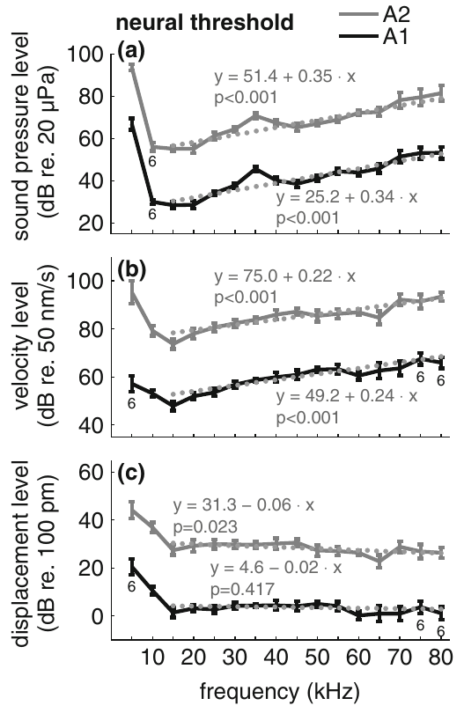
Displacement predicts the threshold for auditory spikes
A neural threshold is the lowest stimulus that meets a stated response criterion. From 15 to 80 kHz, the tympanic displacement at threshold stayed roughly constant. The membrane velocity at threshold rose with frequency instead. A higher-frequency oscillation moves faster while covering the same displacement. Thresholds were measured at each tested frequency across the 15 to 80 kHz band.
The mean threshold displacement was 140 picometers for A1 and 2510 picometers for A2. A picometer is one trillionth of a meter. A1 is the more sensitive acoustic receptor, and A2 is the less sensitive one. A2 required considerably greater membrane movement than A1 to reach the same neural criterion.
Sound-pressure thresholds mix the ear's mechanical response with the receptor's sensitivity. Stable displacement thresholds identify displacement as the mechanical input for these pure tones. The lowest tested frequencies behaved differently from the rest of the range. The displacement data separate the mechanical step from the receptor step. These thresholds used pure tones as the stimuli.
Roeder & Treat (1957), Fig. 2. Published section through the ear and sensory attachment.
ter Hofstede et al. (2011), Fig. 2(a–c). Pressure, velocity and displacement at neural threshold.
ter Hofstede et al. (2011); Roeder & Treat (1957)
11
Notes:
• A **neural threshold** is the lowest stimulus satisfying a stated response criterion. Across 15–80 kHz, the tympanic displacement at threshold remained approximately constant, whereas the corresponding membrane velocity increased with frequency.
• The mean threshold displacement was 140 pm for A1 and 2510 pm for A2. A picometre is one trillionth of a metre. A1 and A2 denote the more sensitive and less sensitive acoustic receptor cells, respectively.
– A higher-frequency oscillation can move faster while covering the same displacement. The relevant comparison is therefore the membrane motion required for the same neural response, not simply whether a loud sound produces a large vibration. A2 required considerably greater movement than A1.
• Sound-pressure thresholds alone combine the ear’s mechanical response with the receptor’s sensitivity. The stable displacement thresholds support displacement as the relevant mechanical input under these pure-tone conditions. They do not prove the identity or gating properties of a transduction channel, and the relationship differs at the lowest tested frequencies.
References:
ter Hofstede HM, Goerlitz HR, Montealegre-Z F, Robert D, Holderied MW (2011). Tympanal mechanics and neural responses in the ears of a noctuid moth. Naturwissenschaften 98: 1057-1061. https://doi.org/10.1007/s00114-011-0851-7
Roeder KD, Treat AE (1957). Ultrasonic reception by the tympanic organ of noctuid moths. Journal of Experimental Zoology 134: 127-157. https://doi.org/10.1002/jez.1401340107
Figure: ter Hofstede et al. (2011), Fig. 2(a–c). Pressure, velocity and displacement at neural threshold.
Figure source: https://doi.org/10.1007/s00114-011-0851-7
Figure: Roeder & Treat (1957), Fig. 2. Published section through the ear and sensory attachment.
Figure source: https://doi.org/10.1002/jez.1401340107

Slide 15
Dissection preserves near-threshold membrane motion
Exposing the auditory nerve could change the ear's biomechanics. So ter Hofstede and colleagues compared the same moth in three conditions: intact in flight orientation, intact inverted, and an inverted preparation with nerve electrodes inserted. Each moth served as its own reference in all three conditions. This comparison isolated the effect of the preparation itself.
Near neural threshold, tympanic velocity and displacement showed no consistent difference across the three conditions. Sound levels were given in dB SPL, a logarithmic measure of sound pressure referenced to 20 micropascals. Both motion measures were taken at the same attachment point. The conditions therefore share a common measurement site.
At stronger stimulation, especially below 35 kHz, dissected preparations could show more membrane movement than intact animals. Near-threshold recordings serve as estimates of intact hearing under the tested conditions. Dissection changed the measured motion mainly at stronger levels. Those differences set the limit of what the near-threshold control can show.
Roeder & Treat (1957), Fig. 2. Published section through the ear and sensory attachment.
ter Hofstede et al. (2011), Fig. 1(a–f). Membrane velocity in intact and dissected preparations.
ter Hofstede et al. (2011); Roeder & Treat (1957)
12
Notes:
• Exposing the auditory nerve could alter the ear’s biomechanics. Ter Hofstede and colleagues therefore compared the same moth in intact flight orientation, intact inverted orientation, and an inverted preparation with the nerve-recording electrodes inserted.
• Near neural threshold, tympanic velocity and displacement showed no consistent difference across those treatments. Sound levels were defined as **dB SPL**, a logarithmic sound-pressure measure referenced to 20 µPa.
– The order of the two intact orientations alternated between animals to reduce an order effect. Removing muscles and inserting an electrode may have little consistent influence near threshold while still changing behavior at stronger sound levels. Validation applies to the measured range rather than to the preparation without limits.
• At stronger stimulation, particularly below 35 kHz, dissected preparations could show greater membrane movement than intact animals. The control supports near-threshold recordings as estimates of intact hearing under the tested conditions. It does not validate every suprathreshold response or every frequency-modulated bat call, because those conditions were not equivalently tested.
References:
ter Hofstede HM, Goerlitz HR, Montealegre-Z F, Robert D, Holderied MW (2011). Tympanal mechanics and neural responses in the ears of a noctuid moth. Naturwissenschaften 98: 1057-1061. https://doi.org/10.1007/s00114-011-0851-7
Roeder KD, Treat AE (1957). Ultrasonic reception by the tympanic organ of noctuid moths. Journal of Experimental Zoology 134: 127-157. https://doi.org/10.1002/jez.1401340107
Figure: ter Hofstede et al. (2011), Fig. 1(a–f). Membrane velocity in intact and dissected preparations.
Figure source: https://doi.org/10.1007/s00114-011-0851-7
Figure: Roeder & Treat (1957), Fig. 2. Published section through the ear and sensory attachment.
Figure source: https://doi.org/10.1002/jez.1401340107

Slide 16
Stronger sound reveals dissection effects
Ter Hofstede and colleagues alternated the order of the two intact orientations between animals. That design reduced an order effect. The inverted preparation placed the moth in a different orientation from flight. Removing muscles and inserting an electrode may have little consistent influence near threshold. Dissection was set against the intact conditions.
The control validates the tested frequency and level range only. Suprathreshold responses and frequency-modulated bat calls were not tested in the same way, so the control leaves those responses untested. Validation applies to the measured range rather than to every stimulus the preparation could receive. The pure-tone conditions set the boundary of that validation.
The same moth served in every condition. Nerve electrodes went into the third condition alone. Each condition was set against the others within one animal. Individual differences stay out of the analysis. Velocity and displacement were both measured at each condition. The conditions for each moth were run in sequence.
Roeder & Treat (1957), Fig. 2. Published section through the ear and sensory attachment.
ter Hofstede et al. (2011), Fig. 1(a–f). Membrane velocity in intact and dissected preparations.
ter Hofstede et al. (2011)
12a
Notes:
• Stronger sound reveals dissection effects.
• Explanation 1.
– Ter Hofstede and colleagues alternated the order of the two intact orientations between animals
– That design reduced an order effect. The inverted preparation placed the moth in a different orientation from flight. Removing muscles and inserting an electrode may have little consistent influence near threshold. Dissection was set against the intact conditions.
• Explanation 2.
– The control validates the tested frequency and level range only
– Suprathreshold responses and frequency-modulated bat calls were not tested in the same way, so the control leaves those responses untested. Validation applies to the measured range rather than to every stimulus the preparation could receive. The pure-tone conditions set the boundary of that validation.
• Explanation 3.
– The same moth served in every condition
– Nerve electrodes went into the third condition alone. Each condition was set against the others within one animal. Individual differences stay out of the analysis. Velocity and displacement were both measured at each condition. The conditions for each moth were run in sequence.
• Source.
– The figure and the measurements come from ter Hofstede et al. (2011).
– Each statement above comes from that paper's text, its figure legend or the speaker notes.
References:
ter Hofstede HM, Goerlitz HR, Montealegre-Z F, Robert D, Holderied MW (2011). Tympanal mechanics and neural responses in the ears of a noctuid moth. Naturwissenschaften 98: 1057-1061. https://doi.org/10.1007/s00114-011-0851-7

Slide 17
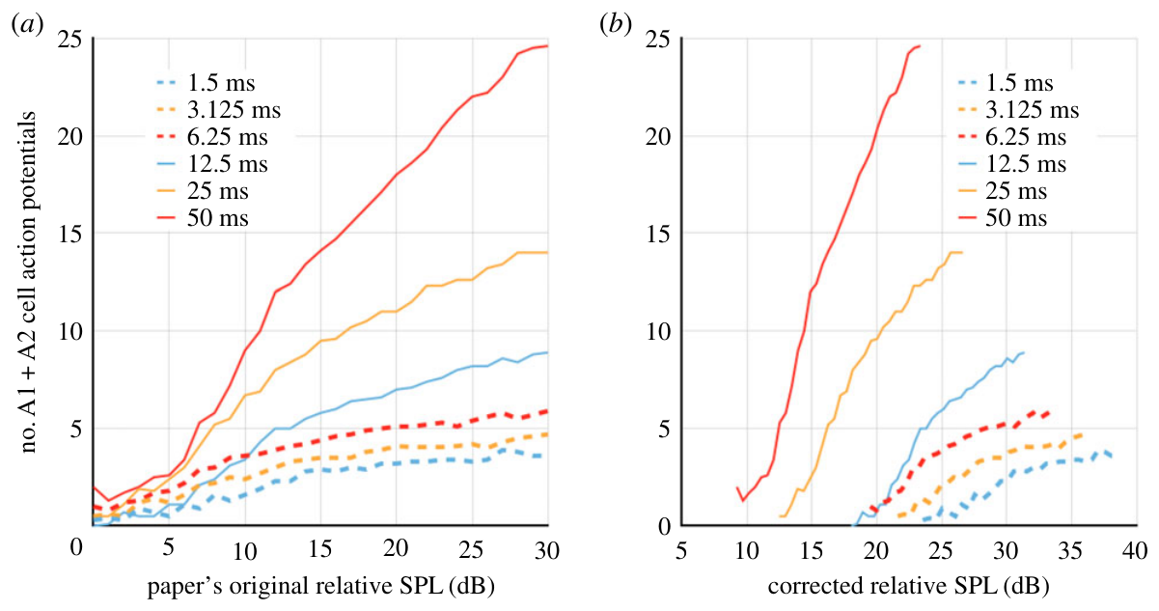
Sound-level meters can bias pulse-duration comparisons
A conventional sound-level meter can average brief pulses through its time-weighting circuit. For the published 1.5 to 50 ms pulses, a constant displayed reading could correspond to different true pulse amplitudes as duration changed. A pulse with a shorter duty cycle can read lower even when its peak pressure is unchanged. The meter's averaging window produces that error.
Thevenon and Pfuhl reanalyzed published moth recordings with a mathematical model of meter damping. Their article compares the original duration-dependent spike curves with curves after the assumed bias was corrected. The correction changes the pressure assigned to each stimulus. The recorded spikes stay the same. Those curves were drawn from the original published spike counts.
Corrected pressures change how spike count appears to depend on duration. The reanalysis used no new moth recordings. Missing meter settings meant the stimuli could be rebuilt in part. The correction rests on modeled assumptions about the meter. Direct historical calibration was not available for these stimuli. Modeled assumptions set the corrected pressures.
Thevenon & Pfuhl (2018), Fig. 6(a–b). Published reanalysis before and after meter correction.
Thevenon & Pfuhl (2018)
13
Notes:
• A conventional sound-level meter can average brief pulses through its time-weighting circuit. For the published 1.5–50-ms pulses, holding the displayed reading constant can require different true pulse amplitudes when duration changes.
• Thevenon and Pfuhl reanalyzed published moth recordings using a mathematical account of meter damping. Their article compares original duration-dependent spike curves with curves after the assumed measurement bias was corrected.
– A pulse with a shorter duty cycle can produce a lower averaged meter reading even when its peak pressure is unchanged. Correcting the measurement does not change the recorded spikes; it changes the pressure assigned to the stimulus that elicited them.
• Corrected pressures change the apparent relation between duration and spike count. This retrospective reanalysis supplies no new moth recordings. Missing meter settings prevent complete reconstruction of the stimuli, so its correction depends on assumptions rather than direct historical calibration.
References:
Thevenon H, Pfuhl G (2018). Discrepancies in the spiking threshold and frequency sensitivity of nocturnal moths explainable by biases in the canonical auditory stimulation method. Royal Society Open Science 5: 172404. https://doi.org/10.1098/rsos.172404
Figure: Thevenon & Pfuhl (2018), Fig. 6(a–b). Published reanalysis before and after meter correction.
Figure source: https://doi.org/10.1098/rsos.172404

Slide 18
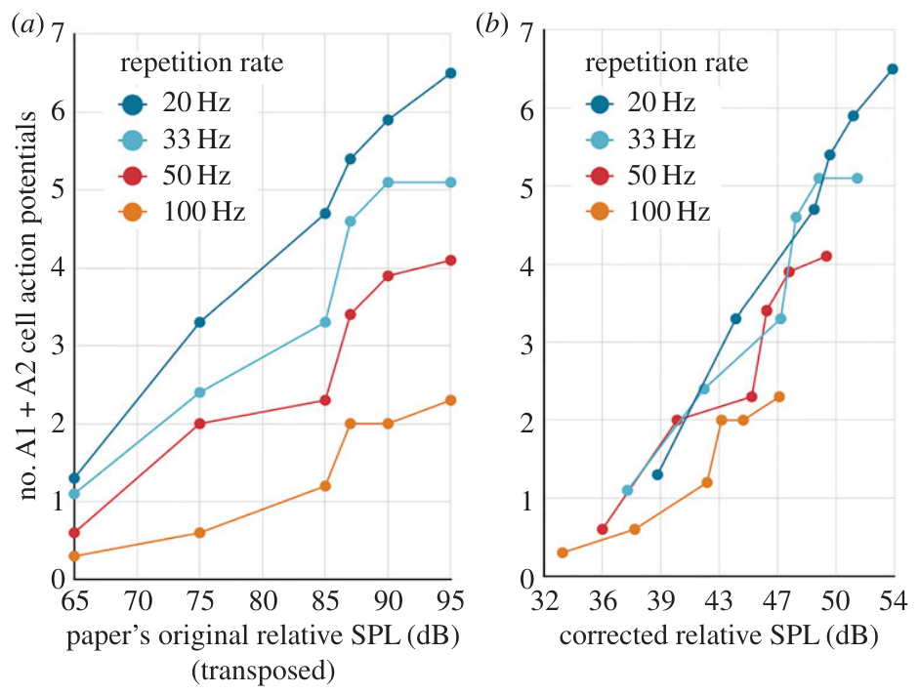
Repetition-rate effects depend on amplitude calibration
Thevenon and Pfuhl also examined published spike responses to pulses repeated at 20, 33, 50 or 100 Hz. More frequent pulses occupy more of the meter's averaging interval. Pulse rate and pulse duration both change how long sound occupies that window. A matched displayed level can hide different instantaneous sound pressures. The same reading can come from unequal stimuli.
Their published correction aligned much of the repetition-rate dependence in the reanalyzed dataset. That result offers a calibration explanation as an alternative to neural adaptation. Fewer spikes per pulse may come from the stimulus rather than from the nerve. Each explanation predicts a different pattern of pressures across the pulse rates.
The source paper could not retrospectively correct every record, because some equipment details were missing. Its corrected plots are evidence about possible measurement bias, not a replacement for the original neural recordings. A stronger test measures the local sound waveform directly, under a defined amplitude convention. Interpreting a reduction in spikes per pulse depends on that calibration.
Thevenon & Pfuhl (2018), Fig. 7(a–b). Published repetition-rate data reanalysis.
Thevenon & Pfuhl (2018)
14
Notes:
• Thevenon and Pfuhl also examined published spike responses to pulses repeated at 20, 33, 50 or 100 Hz. More frequent pulses occupy more of the meter’s averaging interval, so a matched displayed level need not mean matched instantaneous sound pressure.
• Their published correction aligned much of the repetition-rate dependence in the reanalyzed dataset. The result raises a calibration-based alternative to interpreting every reduction in spikes per pulse as neural adaptation.
– Pulse rate and pulse duration both influence the time occupied by sound. The source paper could not retrospectively correct all records because equipment details were missing. Its corrected plots are evidence about possible measurement bias rather than a replacement for the original neural recordings.
• The analysis depends on the modeled damping circuit and information reported in the original methods. It does not establish that adaptation is absent in all moths or all stimulus sequences. A stronger test measures the local sound waveform directly and compares responses under a clearly defined amplitude convention.
References:
Thevenon H, Pfuhl G (2018). Discrepancies in the spiking threshold and frequency sensitivity of nocturnal moths explainable by biases in the canonical auditory stimulation method. Royal Society Open Science 5: 172404. https://doi.org/10.1098/rsos.172404
Figure: Thevenon & Pfuhl (2018), Fig. 7(a–b). Published repetition-rate data reanalysis.
Figure source: https://doi.org/10.1098/rsos.172404

Slide 19
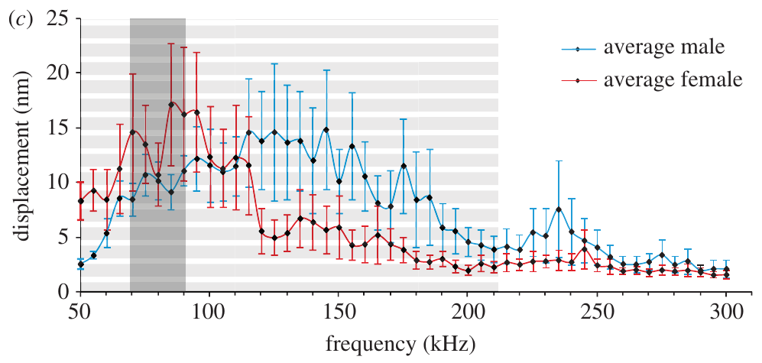
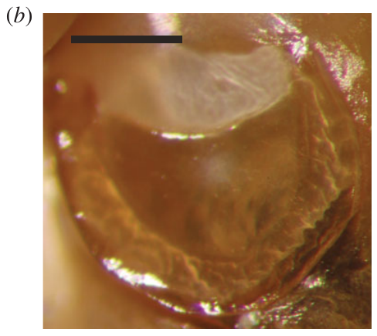
Wax-moth membranes respond across a broad bandwidth
The greater wax moth, Galleria mellonella, has four auditory receptor cells per ear, while the noctuid system has two. Moir and colleagues measured membrane movement optically to find how broadly the tympanum responds to ultrasound. The measurement tracked the membrane itself, not the nerve. The tympanum is a thin, responsive membrane.
At 90 dB SPL, membrane oscillations exceeded 1 nanometer across the tested 50 to 300 kHz range. A nanometer is one billionth of a meter. The largest movement occurred at the sensory attachment rather than across the whole membrane. The female displacement maximum fell near 90 to 95 kHz, inside the reported male calling range.
The membrane must move enough to activate its receptors. Neural responses were measured in a separate experiment, so the broad mechanical bandwidth describes the membrane, not the nerve. Behavioral tests would show whether this bandwidth speeds responses to rapid changes. The broad bandwidth is an observed property of the membrane.
Moir et al. (2013), Fig. 1(c). Membrane displacement at 90 dB SPL.
Moir et al. (2013), Fig. 1(b). Greater wax-moth tympanum; scale bar 0.1 mm.
Moir et al. (2013)
15
Notes:
• The greater wax moth, _Galleria mellonella_, has four auditory receptor cells per ear, contrasting with the two-cell noctuid system. Moir and colleagues measured membrane movement optically to determine how broadly its tympanum responds to ultrasound.
• At 90 dB SPL, membrane oscillations exceeded 1 nm throughout the tested 50–300-kHz range. A nanometre is one billionth of a metre. Maximum movement occurred at the sensory attachment, rather than uniformly across the membrane.
– The female displacement maximum occurred around 90–95 kHz, within the reported male calling range. The paper did not establish a reliable sex difference in mechanical tuning. Mechanical sensitivity and neural sensitivity must remain distinct because each describes a different stage of the ear’s response.
• A mechanically responsive tympanum does not establish neural hearing at every tested frequency. The membrane must move enough to activate its receptors, and neural responses were measured separately. The broad mechanical bandwidth is an observed property; its proposed advantage for rapid temporal responses remains an interpretation requiring behavioral tests.
References:
Moir HM, Jackson JC, Windmill JFC (2013). Extremely high frequency sensitivity in a ‘simple’ ear. Biology Letters 9: 20130241. https://doi.org/10.1098/rsbl.2013.0241
Figure: Moir et al. (2013), Fig. 1(c). Membrane displacement at 90 dB SPL.
Figure source: https://doi.org/10.1098/rsbl.2013.0241
Figure: Moir et al. (2013), Fig. 1(b). Greater wax-moth tympanum; scale bar 0.1 mm.
Figure source: https://doi.org/10.1098/rsbl.2013.0241

Slide 20
Membrane motion peaks at the attachment
The female displacement maximum occurred around 90 to 95 kHz. That band lies within the reported male calling range of this species, so the membrane's tuning overlaps the calls it may hear. That tuning peak is a membrane property measured optically. Sound pressure of 90 dB SPL set the level for the membrane readings.
The paper found no reliable sex difference in mechanical tuning. Mechanical sensitivity and neural sensitivity must remain distinct because each describes a different stage of the ear's response. Sensitivity and tuning are separate questions in this experiment. Each stage of the response needs its own measurement.
The membrane measurements were made at 90 dB SPL, so the displacement values describe that sound level. The optical method tracked the membrane surface across the full 50 to 300 kHz range. Displacement was the quantity recorded at each frequency. Each tested frequency gave its own displacement value.
Moir et al. (2013), Fig. 1(c). Membrane displacement at 90 dB SPL.
Moir et al. (2013), Fig. 1(b). Greater wax-moth tympanum; scale bar 0.1 mm.
Moir et al. (2013)
15a
Notes:
• Membrane motion peaks at the attachment.
• Explanation 1.
– The female displacement maximum occurred around 90 to 95 kHz
– That band lies within the reported male calling range of this species, so the membrane's tuning overlaps the calls it may hear. That tuning peak is a membrane property measured optically. Sound pressure of 90 dB SPL set the level for the membrane readings.
• Explanation 2.
– The paper found no reliable sex difference in mechanical tuning
– Mechanical sensitivity and neural sensitivity must remain distinct because each describes a different stage of the ear's response. Sensitivity and tuning are separate questions in this experiment. Each stage of the response needs its own measurement.
• Explanation 3.
– The membrane measurements were made at 90 dB SPL, so the displacement values describe that sound level
– The optical method tracked the membrane surface across the full 50 to 300 kHz range. Displacement was the quantity recorded at each frequency. Each tested frequency gave its own displacement value.
• Source.
– The figure and the measurements come from Moir et al. (2013).
– Each statement above comes from that paper's text, its figure legend or the speaker notes.
References:
Moir HM, Jackson JC, Windmill JFC (2013). Extremely high frequency sensitivity in a ‘simple’ ear. Biology Letters 9: 20130241. https://doi.org/10.1098/rsbl.2013.0241

Slide 21
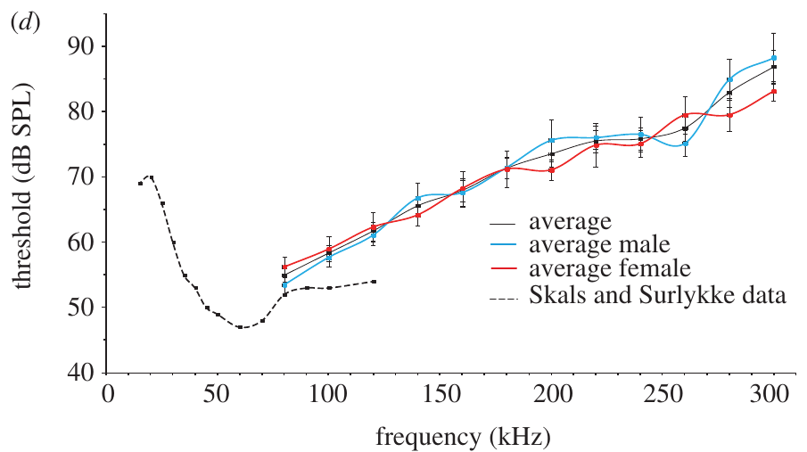
Wax-moth receptors respond at frequencies up to 300 kHz
Moir and colleagues recorded the wax moth's auditory nerve during 20 ms pure-tone pulses. A response criterion counted only spikes that followed each sound, not spontaneous firing. They required repeated sound-driven spikes before counting a response. That rule cut down on counting random firing as hearing. Spontaneous firing was excluded from the thresholds.
The lowest measured threshold was about 55 dB SPL at 80 kHz. In responding animals, thresholds rose to about 83 dB SPL at 280 kHz and 87 dB SPL at 300 kHz. Some animals gave no response at the highest tested level, 90 dB SPL. Those animals are counted separately from the responders.
Neural sensitivity reached 300 kHz in this species, with the best sensitivity near 80 kHz. A threshold curve reports sensitivity rather than the loudness of a call heard outdoors. Higher thresholds mean that stronger sound is needed to evoke spikes. The authors called for behavioral studies to test whether the extreme frequencies lead to defensive responses.
Moir et al. (2013), Fig. 1(d). Neural thresholds across frequency.
Moir et al. (2013), Fig. 1(b). Greater wax-moth tympanum; scale bar 0.1 mm.
Moir et al. (2013)
16
Notes:
• Moir and colleagues recorded the wax moth’s auditory nerve during 20-ms pure-tone pulses. A response criterion requiring repeated sound-associated spikes reduced the chance of mistaking spontaneous firing for an auditory response.
• The lowest measured threshold was approximately 55 dB SPL at 80 kHz. In responding animals, thresholds rose to approximately 83 dB SPL at 280 kHz and 87 dB SPL at 300 kHz; some animals did not respond at the maximum tested 90 dB SPL.
– The threshold curve reports sensitivity, not the loudness of a call normally encountered outdoors. Higher thresholds mean that stronger sound is required to evoke spikes. The authors explicitly called for behavioral studies to test whether the extreme frequencies lead to defensive responses.
• These recordings establish neural sensitivity to exceptionally high frequencies in this preparation. They do not establish effective flight avoidance at 300 kHz or a natural bat threat using that frequency. The ecological purpose of the extended sensitivity was unresolved in the study.
References:
Moir HM, Jackson JC, Windmill JFC (2013). Extremely high frequency sensitivity in a ‘simple’ ear. Biology Letters 9: 20130241. https://doi.org/10.1098/rsbl.2013.0241
Figure: Moir et al. (2013), Fig. 1(d). Neural thresholds across frequency.
Figure source: https://doi.org/10.1098/rsbl.2013.0241
Figure: Moir et al. (2013), Fig. 1(b). Greater wax-moth tympanum; scale bar 0.1 mm.
Figure source: https://doi.org/10.1098/rsbl.2013.0241

Slide 22
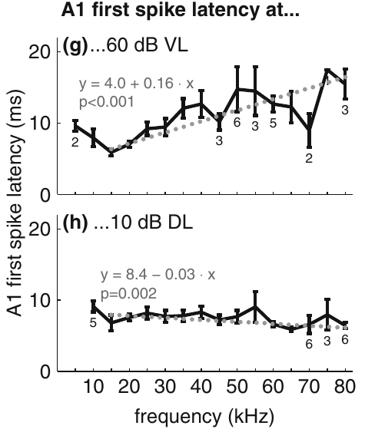
Constant displacement stabilizes A1 response latency
First-spike latency is the delay between stimulus arrival and the first auditory action potential. Ter Hofstede and colleagues measured A1 latency while they held either membrane velocity or displacement constant across frequencies. Each condition isolated one mechanical variable. The first spike is the earliest neural sign of stimulation. The A1 cell was the unit measured in these latency records.
At constant displacement, the first spike stayed near 7 ms across most of the tested range. At constant velocity, latency rose with frequency. These latencies matched the displacement thresholds that the same group measured separately. The match shows displacement as the input that sets timing. The displacement thresholds were obtained independently of the latency measures.
Displacement controls receptor excitation more closely than velocity under these conditions. The experiment ties mechanical input to the timing of neural output, not only to whether a spike occurs. Constant displacement preserves timing, which is a second test of the mechanical-input hypothesis. The generator potential sits between these steps and was never recorded.
Roeder & Treat (1957), Fig. 2. Published section through the ear and sensory attachment.
ter Hofstede et al. (2011), Fig. 2(g–h). A1 latency at constant velocity or displacement.
ter Hofstede et al. (2011); Roeder & Treat (1957)
17
Notes:
• **First-spike latency** is the delay between stimulus arrival and the first auditory action potential. Ter Hofstede and colleagues measured A1 latency while holding either membrane velocity or displacement constant across frequencies.
• At constant displacement, the first spike remained near 7 ms over most of the tested range. At constant velocity, latency increased with frequency. The relationship was consistent with the displacement-based thresholds obtained independently.
– A generator potential is the local graded electrical response that precedes spike production. The study recorded the resulting spikes and membrane movement, rather than directly measuring that potential. Constant displacement preserving timing is a second test of the mechanical-input hypothesis.
• Displacement constrains receptor excitation more closely than velocity under these conditions. The experiment links the mechanical input to the timing of neuronal output, rather than only to the presence of spikes. The extracellular record still does not separate the receptor’s generator potential from the subsequent ionic mechanisms producing an action potential.
References:
ter Hofstede HM, Goerlitz HR, Montealegre-Z F, Robert D, Holderied MW (2011). Tympanal mechanics and neural responses in the ears of a noctuid moth. Naturwissenschaften 98: 1057-1061. https://doi.org/10.1007/s00114-011-0851-7
Roeder KD, Treat AE (1957). Ultrasonic reception by the tympanic organ of noctuid moths. Journal of Experimental Zoology 134: 127-157. https://doi.org/10.1002/jez.1401340107
Figure: ter Hofstede et al. (2011), Fig. 2(g–h). A1 latency at constant velocity or displacement.
Figure source: https://doi.org/10.1007/s00114-011-0851-7
Figure: Roeder & Treat (1957), Fig. 2. Published section through the ear and sensory attachment.
Figure source: https://doi.org/10.1002/jez.1401340107

Slide 23
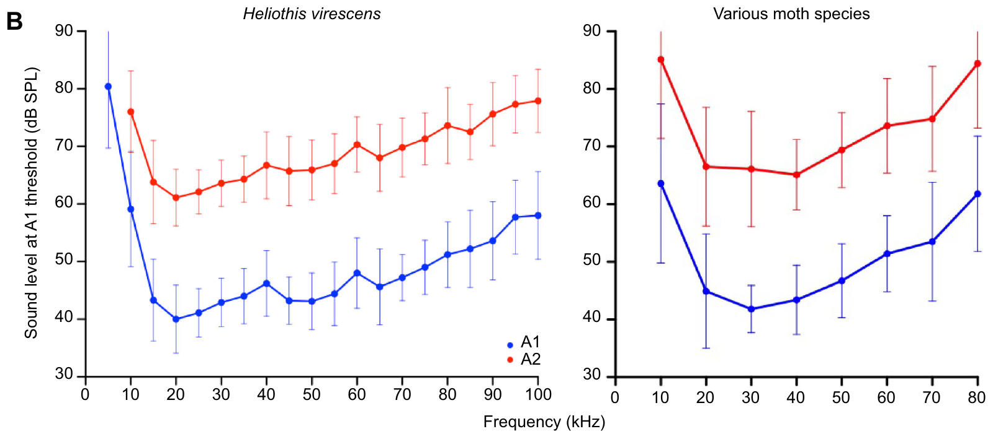
A1 and A2 sample different sound-level ranges
Gordon and ter Hofstede compared acoustic thresholds in noctuid and erebid moths using extracellular auditory-nerve recordings. An audiogram plots the sound level needed to evoke a set response at each frequency. Audiograms show sensitivity across the whole tested frequency range for each cell. The study covered two moth families. The erebid comparison extended the noctuid results.
The moths were most sensitive between 15 and 55 kHz. A2 thresholds usually exceeded A1 thresholds by 15 to 20 dB. At 5 to 10 kHz, the moths needed substantially stronger sound than at their best frequencies. Thresholds also rose at higher ultrasonic frequencies. The thresholds were measured for A1 and A2 as separate cells.
The two cells widen the range of sound levels that can change the nerve signal. A threshold gap alone assigns no behavior to either neuron. Frequency-dependent sensitivity is a property of the nerve, not a pitch judgment by the moth. The curves describe the input the nerve receives. Nerve recordings reveal the threshold separation directly.
Gordon & ter Hofstede (2018), Fig. 1(B). A1 and A2 frequency thresholds.
Roeder & Treat (1957), Fig. 2. Published section through the ear and sensory attachment.
Gordon & ter Hofstede (2018); Roeder & Treat (1957)
18
Notes:
• Gordon and ter Hofstede compared acoustic thresholds in noctuid and erebid moths using extracellular auditory-nerve recordings. An **audiogram** is the relationship between stimulus frequency and the level needed to evoke a specified response.
• The moths were most sensitive between 15 and 55 kHz. A2 thresholds generally exceeded A1 thresholds by 15–20 dB. At 5–10 kHz, substantially stronger sound was needed, and thresholds also increased at higher ultrasonic frequencies.
– The recording and comparison distinguish the more sensitive A1 cell from A2 using threshold, timing and spike form together. The curves concern sound at the ear, referenced to a stated calibration. They are not direct measurements of a bat’s distance or of a freely flying moth’s escape decision.
• The two cells expand the range of sound levels that can influence the nerve signal. Threshold separation does not assign a distinct behavior to either neuron. It also does not imply that the animal discriminates pitch, because frequency-dependent sensitivity can exist without an output that uniquely identifies sound frequency.
References:
Gordon SD, ter Hofstede HM (2018). The influence of bat echolocation call duration and timing on auditory encoding of predator distance in noctuoid moths. Journal of Experimental Biology 221: jeb171561. https://doi.org/10.1242/jeb.171561
Roeder KD, Treat AE (1957). Ultrasonic reception by the tympanic organ of noctuid moths. Journal of Experimental Zoology 134: 127-157. https://doi.org/10.1002/jez.1401340107
Figure: Gordon & ter Hofstede (2018), Fig. 1(B). A1 and A2 frequency thresholds.
Figure source: https://doi.org/10.1242/jeb.171561
Figure: Roeder & Treat (1957), Fig. 2. Published section through the ear and sensory attachment.
Figure source: https://doi.org/10.1002/jez.1401340107

Slide 24
Frequency sensitivity without pitch identity
Gordon and ter Hofstede compared the two cells across frequency using extracellular nerve recordings. Each cell's threshold curve was measured separately, so the two curves can be read side by side. The erebid moths added a second noctuoid family to the data. Both cells were measured at the same frequencies.
Threshold separation between A1 and A2 assigns no distinct behavior to either neuron. The curves describe nerve input rather than an animal's response. Each cell adds its own threshold to the range of sound levels the nerve can signal. Gordon and ter Hofstede separated the cells by their threshold curves. A threshold gap is a property of the recording, not a behavior.
Frequency-dependent sensitivity can exist without an output that identifies sound frequency. That is a property of the nerve's response, not of a pitch judgment made by the moth. Discriminating pitch would need a separate measure from the animal. The result describes the nerve's sensitivity profile in these moths. Gordon and ter Hofstede measured this profile for both cells.
Gordon & ter Hofstede (2018), Fig. 1(B). A1 and A2 frequency thresholds.
Roeder & Treat (1957), Fig. 2. Published section through the ear and sensory attachment.
Gordon & ter Hofstede (2018)
18a
Notes:
• Frequency sensitivity without pitch identity.
• Explanation 1.
– Gordon and ter Hofstede compared the two cells across frequency using extracellular nerve recordings
– Each cell's threshold curve was measured separately, so the two curves can be read side by side. The erebid moths added a second noctuoid family to the data. Both cells were measured at the same frequencies.
• Explanation 2.
– Threshold separation between A1 and A2 assigns no distinct behavior to either neuron
– The curves describe nerve input rather than an animal's response. Each cell adds its own threshold to the range of sound levels the nerve can signal. Gordon and ter Hofstede separated the cells by their threshold curves. A threshold gap is a property of the recording, not a behavior.
• Explanation 3.
– Frequency-dependent sensitivity can exist without an output that identifies sound frequency
– That is a property of the nerve's response, not of a pitch judgment made by the moth. Discriminating pitch would need a separate measure from the animal. The result describes the nerve's sensitivity profile in these moths. Gordon and ter Hofstede measured this profile for both cells.
• Source.
– The figure and the measurements come from Gordon & ter Hofstede (2018).
– Each statement above comes from that paper's text, its figure legend or the speaker notes.
References:
Gordon SD, ter Hofstede HM (2018). The influence of bat echolocation call duration and timing on auditory encoding of predator distance in noctuoid moths. Journal of Experimental Biology 221: jeb171561. https://doi.org/10.1242/jeb.171561

Slide 25
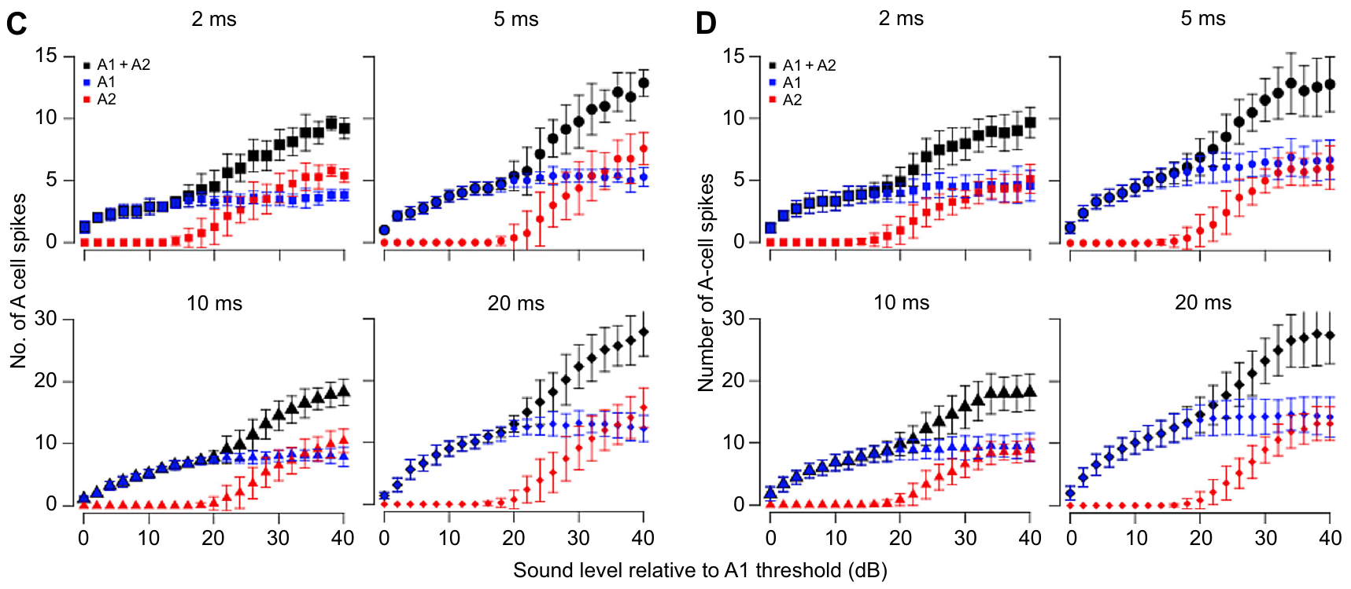
A2 extends coding after A1 activity begins to saturate
Range fractionation divides a sensory intensity range among receptors with different thresholds. In moths, A1 starts responding at lower levels, and A2 joins when the sound gets stronger. Together the two cells cover more of the sound-level range than either covers alone. Each cell takes its own part of the range.
Gordon and ter Hofstede measured separate A1 and A2 spike counts for 50 kHz pulses lasting 2, 5, 10 or 20 ms. Longer pulses often raised A1 output toward the level where A2 began firing. Pulse duration set how far A1 could climb before A2 joined. The counts were taken from the same recordings for each duration.
A1 can plateau before A2 turns on when pulses are short. That leaves a gap in count-based intensity coding. A2 extends the coding range, yet the same sound level can yield different counts at different durations. Counts from short pulses leave much of the range uncoded. Short pulses can leave A1 saturated before any A2 spike appears.
Gordon & ter Hofstede (2018), Fig. 2(C–D). Separate A1 and A2 intensity responses by duration.
Roeder & Treat (1957), Fig. 2. Published section through the ear and sensory attachment.
Gordon & ter Hofstede (2018); Roeder & Treat (1957)
19
Notes:
• **Range fractionation** divides a sensory intensity range among receptors with different thresholds. In moths, A1 begins responding at lower levels and A2 is recruited when the sound is stronger.
• Gordon and ter Hofstede measured separate A1 and A2 spike counts for 50-kHz pulses lasting 2, 5, 10 or 20 ms. Longer pulses often permitted A1 output to increase toward the level at which A2 began firing.
– Saturation means that raising the input no longer increases the selected output measure. Here the selected measure is spikes per sound pulse. The output of the two cells must be examined separately because their sum can conceal a plateau in A1 before A2 begins to contribute.
• For short pulses, A1 could reach a plateau before A2 was recruited, leaving a gap in count-based intensity coding. A2 therefore extends the ear’s coding range but does not guarantee uninterrupted information at every duration. The same sound level can yield different spike counts when pulse duration changes.
References:
Gordon SD, ter Hofstede HM (2018). The influence of bat echolocation call duration and timing on auditory encoding of predator distance in noctuoid moths. Journal of Experimental Biology 221: jeb171561. https://doi.org/10.1242/jeb.171561
Roeder KD, Treat AE (1957). Ultrasonic reception by the tympanic organ of noctuid moths. Journal of Experimental Zoology 134: 127-157. https://doi.org/10.1002/jez.1401340107
Figure: Gordon & ter Hofstede (2018), Fig. 2(C–D). Separate A1 and A2 intensity responses by duration.
Figure source: https://doi.org/10.1242/jeb.171561
Figure: Roeder & Treat (1957), Fig. 2. Published section through the ear and sensory attachment.
Figure source: https://doi.org/10.1002/jez.1401340107

Slide 26
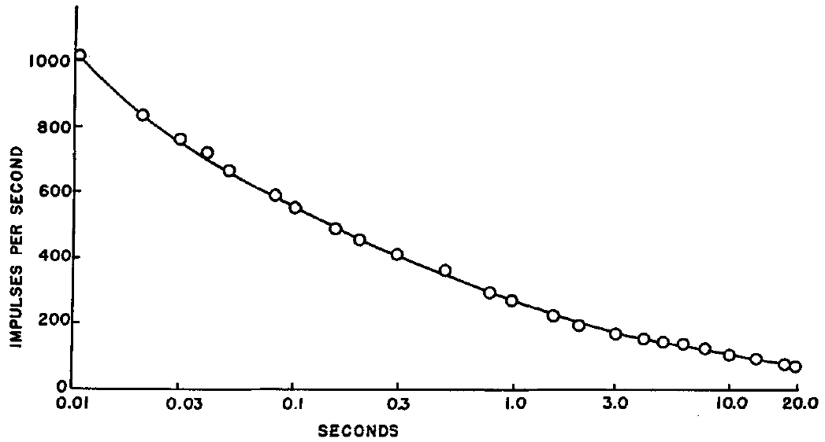
A sustained tone rapidly adapts the acoustic response
Adaptation is a reduction in sensory response during continuing or repeated stimulation. Roeder and Treat followed the more sensitive acoustic unit during a sustained 70 kHz tone and counted its spikes over time. The count covered the full length of the tone. The record came from a single recorded unit.
The initial rate approached 1000 spikes per second. It fell to about half that within 0.1 s and to roughly a quarter by 1 s. A slower decline continued toward an irregular discharge near 90 spikes per second. The initial and later rates belong to the same recorded response. Overlapping spikes at high intensity made counts unreliable in some recordings.
Peripheral output falls over time while the sound keeps playing. Receptor mechanics, transduction and spike-generating conductances are three possible sources of the drop. Identifying the right one needs measurements inside the receptor. The adaptation curve is one readout of that process. This experiment did not record sound pressure, so the curve has no absolute intensity.
Roeder & Treat (1957), Fig. 6. Spike-rate adaptation to a 70-kHz tone.
Roeder & Treat (1957), Fig. 2. Published section through the ear and sensory attachment.
Roeder & Treat (1957)
20
Notes:
• **Adaptation** is a reduction in sensory response during continuing or repeated stimulation. Roeder and Treat followed the more sensitive acoustic unit during a sustained 70-kHz tone and counted its spikes over time.
• In that recording, the initial rate approached 1000 spikes per second, fell to about half that rate within 0.1 s, and reached roughly one quarter by 1 s. A slower decline continued toward an irregular discharge near 90 spikes per second.
– The initial and later rates belong to the same recorded response, rather than to different receptor populations. Overlapping spikes often prevented reliable counts at high intensity; this recording was selected because the sensitive unit could be distinguished. The mechanism of the rate decline remained unresolved.
• The result establishes a time-dependent change in the peripheral output despite continuing sound. It does not identify whether the change originates in receptor mechanics, transduction or spike-generating conductances. Because sound pressure was not measured in this particular experiment, the curve cannot be assigned a precise absolute intensity.
References:
Roeder KD, Treat AE (1957). Ultrasonic reception by the tympanic organ of noctuid moths. Journal of Experimental Zoology 134: 127-157. https://doi.org/10.1002/jez.1401340107
Figure: Roeder & Treat (1957), Fig. 6. Spike-rate adaptation to a 70-kHz tone.
Figure source: https://doi.org/10.1002/jez.1401340107
Figure: Roeder & Treat (1957), Fig. 2. Published section through the ear and sensory attachment.
Figure source: https://doi.org/10.1002/jez.1401340107

Slide 27
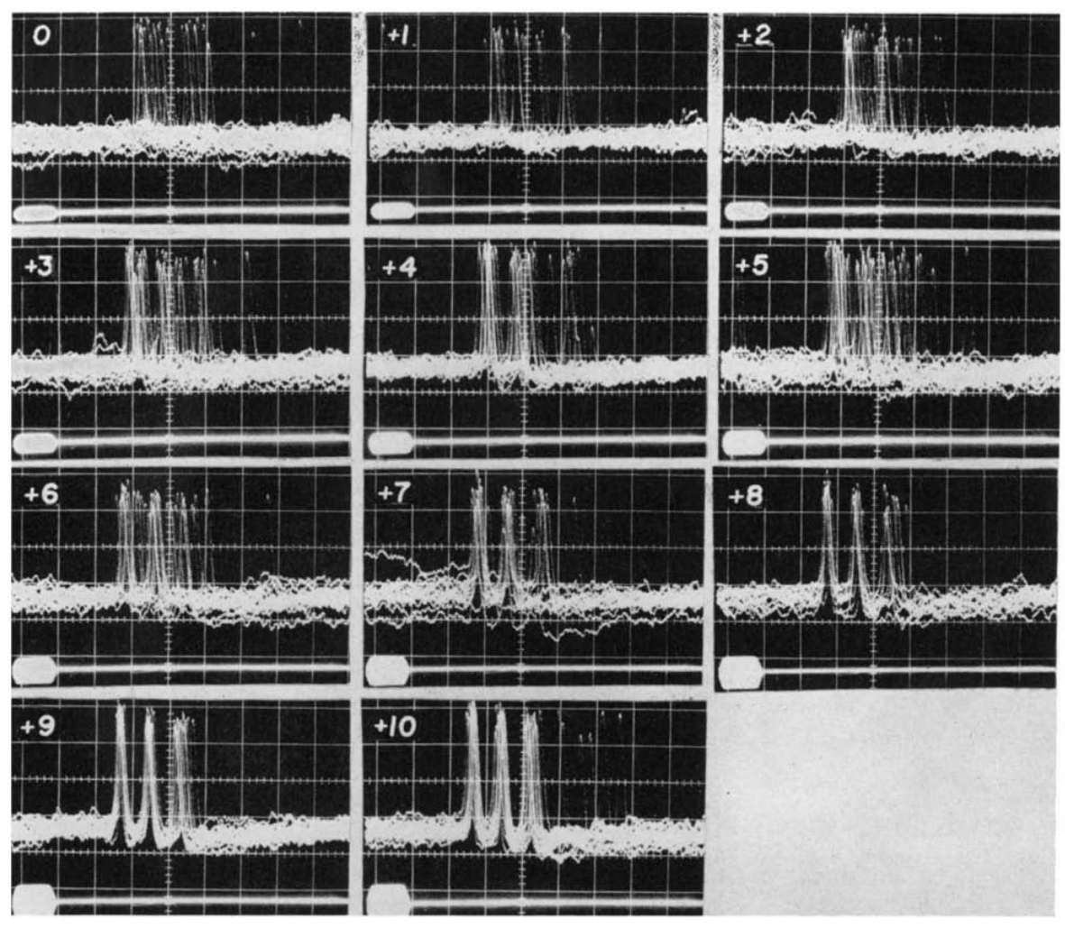
Stronger pulses shorten peripheral response latency
Roeder recorded tympanic responses to repeated short ultrasonic pulses. He raised the amplitude in calibrated steps relative to each preparation's threshold. This isolated changes in timing and spike count from changes in pulse frequency or duration. The pulses were repeated while the amplitude was changed. The steps were set at 1 dB increments near threshold.
After subtracting the 2.9 ms sound travel delay over 1 m, the biological response time ran from about 3.2 to 4.0 ms near threshold down to 1.9 ms at the strongest level. Timing also varied more near threshold than at higher levels. The delay includes axonal conduction between the receptor and the electrode.
A shorter delay fits faster excitation of the receptor as the stimulus gets stronger. The generator potential was never recorded directly, so the excitation step is inferred from spike timing. Roeder treated the axonal part of the delay as roughly constant within one preparation. The latency was tied to the stimulus onset in each preparation.
Roeder & Treat (1957), Fig. 2. Published section through the ear and sensory attachment.
Roeder (1964), Fig. 2. Near-threshold responses at 1-dB increments.
Roeder (1964); Roeder & Treat (1957)
21
Notes:
• Roeder recorded tympanic responses to repeated short ultrasonic pulses while increasing amplitude in calibrated increments relative to an individual preparation’s threshold. This isolates changes in timing and spike count from changes in pulse frequency or duration.
• After subtracting the 2.9-ms sound-transmission delay over 1 m, the biological response time ranged from approximately 3.2–4.0 ms near threshold to 1.9 ms at the strongest tested level. Timing was also more variable near threshold.
– The biological delay still includes axonal conduction between the receptor and recording electrode. Roeder treated that component as approximately constant within the same preparation. Subtracting sound travel time avoids treating a physical delay through air as part of the neuron’s excitation process.
• The shorter delay is consistent with faster excitation of the receptor as sound grows stronger. The generator potential was not successfully measured intracellularly, so its rate of rise remained an explanation rather than an observed mechanism. An external onset marker permits this latency measurement; a flying moth must obtain useful timing information from its own sensory signals.
References:
Roeder KD (1964). Aspects of the noctuid tympanic nerve response having significance in the avoidance of bats. Journal of Insect Physiology 10: 529-546. https://doi.org/10.1016/0022-1910(64)90025-3
Roeder KD, Treat AE (1957). Ultrasonic reception by the tympanic organ of noctuid moths. Journal of Experimental Zoology 134: 127-157. https://doi.org/10.1002/jez.1401340107
Figure: Roeder (1964), Fig. 2. Near-threshold responses at 1-dB increments.
Figure source: https://doi.org/10.1016/0022-1910(64)90025-3
Figure: Roeder & Treat (1957), Fig. 2. Published section through the ear and sensory attachment.
Figure source: https://doi.org/10.1002/jez.1401340107

Slide 28
Latency shortens as sound grows stronger
Roeder measured tympanic responses to brief pulses presented in succession. He stepped the amplitude up in calibrated increments against each preparation's threshold. Responses near threshold were measured at 1 dB increments, which gave fine resolution at the lowest levels. Timing and spike count were measured at each step.
The external onset marker permits this latency measurement. Timing was more variable near threshold, which is when the stimulus is weakest. Some of that delay is axonal conduction from the receptor to the recording site. The delay is reported after that correction. The delay was measured in the same preparations at each level.
Roeder and Treat's section shows the attachment that drives this receptor, a structure in the ear rather than in the brain. A flying moth lacks an external marker and must obtain timing from its own sensory signals. Roeder's latency values came from a single preparation. The section is a published reconstruction, not a live recording.
Roeder & Treat (1957), Fig. 2. Published section through the ear and sensory attachment.
Roeder (1964), Fig. 2. Near-threshold responses at 1-dB increments.
Roeder (1964)
21a
Notes:
• Latency shortens as sound grows stronger.
• Explanation 1.
– Roeder measured tympanic responses to brief pulses presented in succession
– He stepped the amplitude up in calibrated increments against each preparation's threshold. Responses near threshold were measured at 1 dB increments, which gave fine resolution at the lowest levels. Timing and spike count were measured at each step.
• Explanation 2.
– The external onset marker permits this latency measurement
– Timing was more variable near threshold, which is when the stimulus is weakest. Some of that delay is axonal conduction from the receptor to the recording site. The delay is reported after that correction. The delay was measured in the same preparations at each level.
• Explanation 3.
– Roeder and Treat's section shows the attachment that drives this receptor, a structure in the ear rather than in the brain
– A flying moth lacks an external marker and must obtain timing from its own sensory signals. Roeder's latency values came from a single preparation. The section is a published reconstruction, not a live recording.
• Source.
– The figure and the measurements come from Roeder (1964).
– Each statement above comes from that paper's text, its figure legend or the speaker notes.
References:
Roeder KD (1964). Aspects of the noctuid tympanic nerve response having significance in the avoidance of bats. Journal of Insect Physiology 10: 529-546. https://doi.org/10.1016/0022-1910(64)90025-3

Slide 29
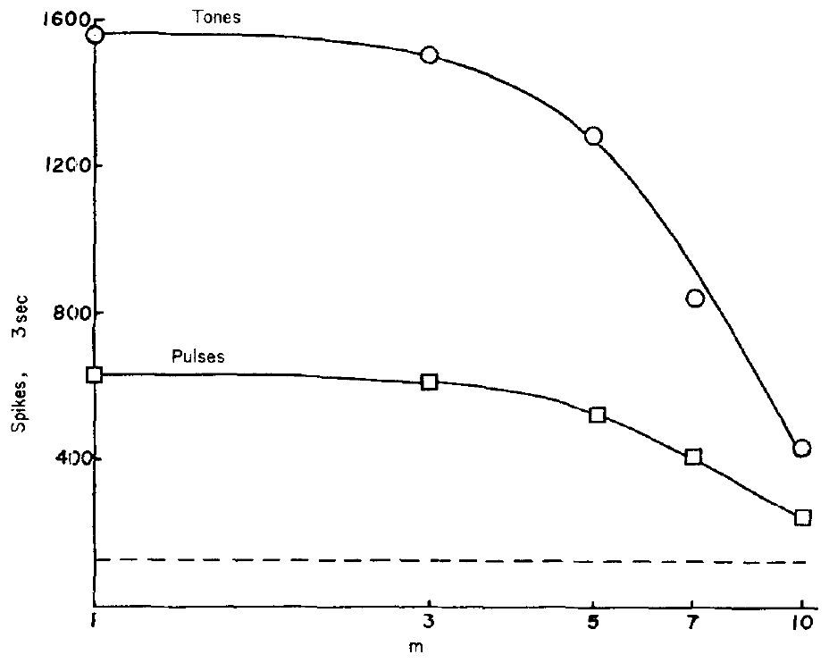
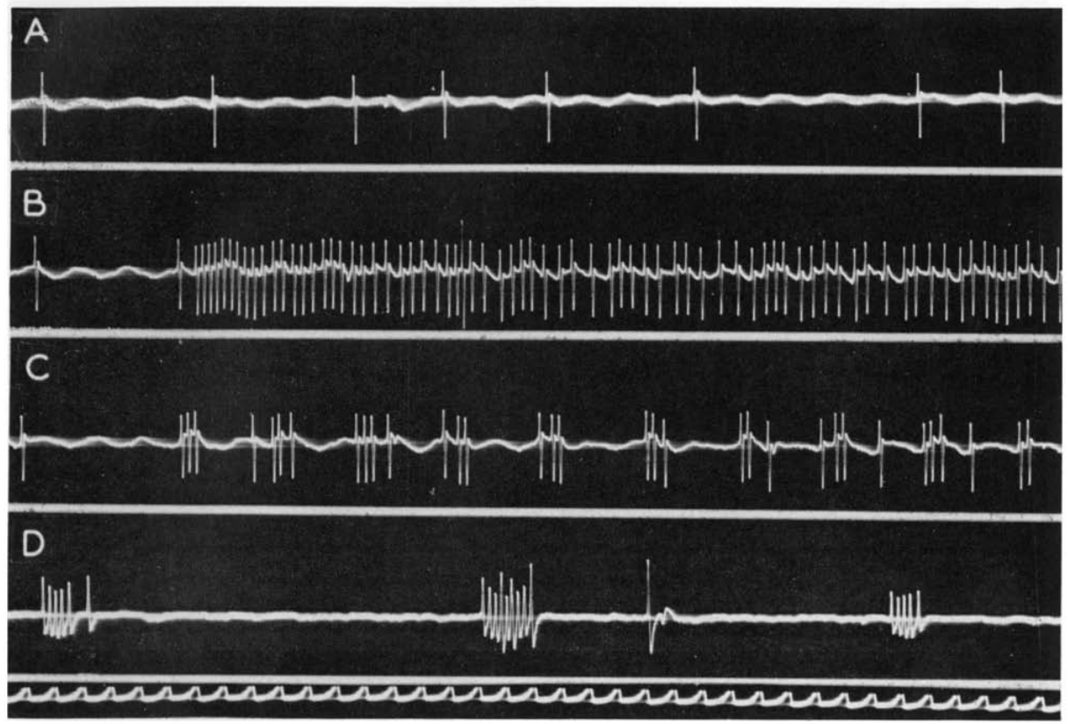
Total spike count does not predict pulse effectiveness
Roeder compared free-flight behavior during pulsed ultrasound with continuous tones at the same frequency and amplitude. Moths turned away far more often during pulses, while tones produced more total A1 spikes in a matched interval. The pulse pattern was the difference between the two stimuli. The tone and the pulses shared a frequency.
For the 60 kHz comparison, 3 ms pulses repeated 30 times per second were set against a continuous tone. Recordings at several source distances paired each acoustic condition with a nerve response. The source distance changed the received level in each comparison. Bat calls recorded in the same study were used for comparison.
Tones produced longer spike trains, but they adapted more quickly. Pulses repeatedly generated short-interval bursts. Behavior followed the temporal pattern of the sound, so total spike count was not enough to predict it. The temporal organization of the sound was the variable that mattered. The analysis covered both total counts and the timing of the bursts.
Roeder (1964), Fig. 4. Spike counts for tones and pulses over distance.
Roeder (1964), Fig. 5(A–D). Spontaneous activity, tone, pulses and bat calls.
Roeder (1964)
22
Notes:
• Roeder compared free-flight behavior during pulsed ultrasound and continuous tones of the same frequency and amplitude. Turning away occurred much more often with pulses, while tones elicited more total A1 spikes during a matched recording interval.
• For the 60-kHz comparison, 3-ms pulses repeated 30 times per second were compared with a continuous tone. Recordings made at different source distances linked the same acoustic conditions to the nerve response.
– The field signals were alternated over the evening to reduce changes in the moth population as a confound. An initial observer-blind schedule reduced classification bias. Behavioral observations pooled unidentified flying moths, whereas nerve recordings came from identified preparations, limiting a precise neuron-to-behavior assignment.
• Tones produced longer spike trains but adapted more rapidly; pulses repeatedly generated short-interval bursts. The result rejects total afferent spike count alone as a sufficient explanation of behavioral effectiveness. It supports sensitivity to temporal organization, without proving the exact central filter that selects the effective pattern.
References:
Roeder KD (1964). Aspects of the noctuid tympanic nerve response having significance in the avoidance of bats. Journal of Insect Physiology 10: 529-546. https://doi.org/10.1016/0022-1910(64)90025-3
Figure: Roeder (1964), Fig. 4. Spike counts for tones and pulses over distance.
Figure source: https://doi.org/10.1016/0022-1910(64)90025-3
Figure: Roeder (1964), Fig. 5(A–D). Spontaneous activity, tone, pulses and bat calls.
Figure source: https://doi.org/10.1016/0022-1910(64)90025-3

Slide 30
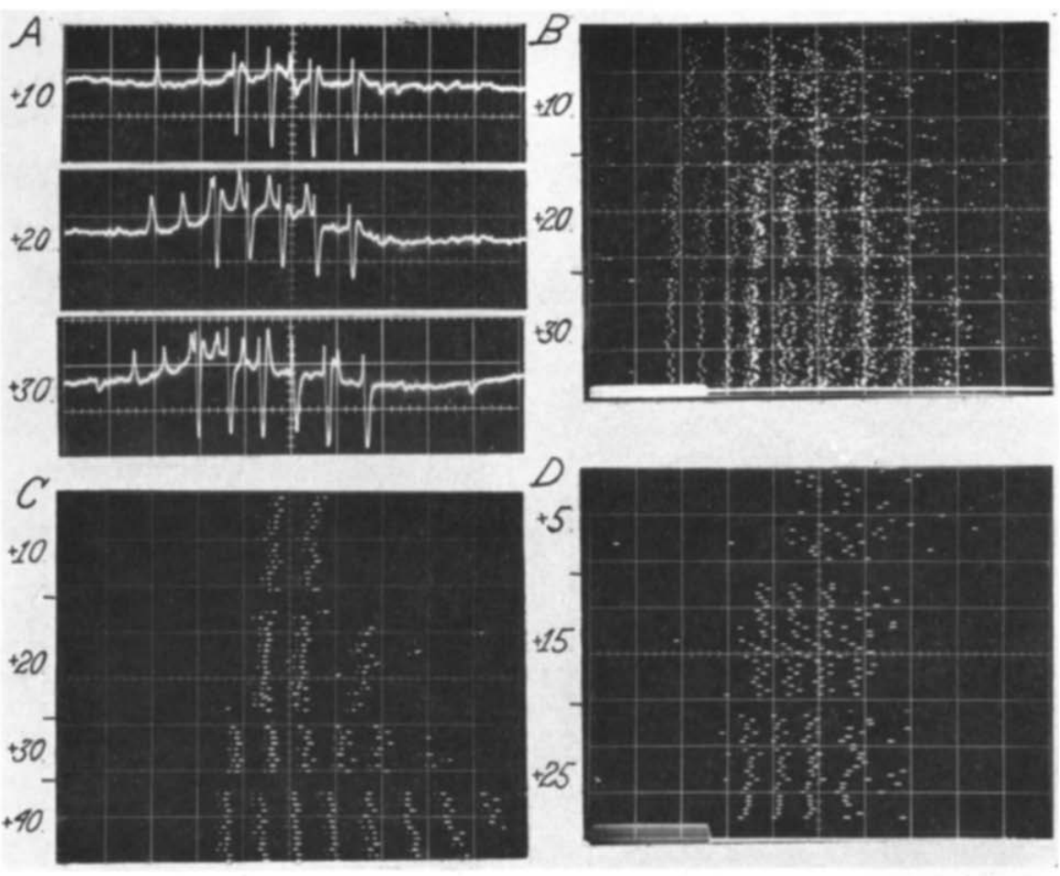
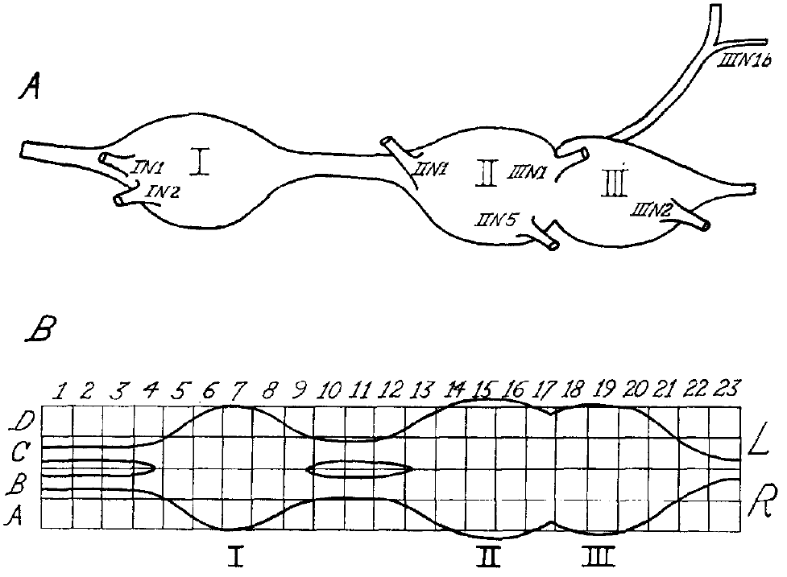
Thoracic repeaters relay the afferent burst
An interneuron is a central neuron that joins sensory input to other central processing or motor pathways. Roeder recorded sound-responsive activity within the thoracic ganglia, the nerve-cell clusters that control flight. Those recordings placed the activity in the central nervous system. The units were recorded at specific coordinates within the ganglia.
Some units closely repeated the A1 burst but fired later. These repeater neurons included crossed responses that passed to the opposite side and ipsilateral responses that continued toward the head. Simultaneous recordings showed that repeater spikes came after A1 spikes. The temporal ordering separated the two sets of spikes. Crossed responses reached the opposite side of the ganglion.
Central neurons carry the tympanic signal onward and change its timing during longer sounds. Synapses are functional junctions between neurons. The extracellular recordings measured spikes, not the chemistry at each junction. The transmitter at each junction stayed unidentified in these records. Those junctions join the sensory input to the relay units that follow.
Roeder (1966), Fig. 1(A–B). Thoracic ganglia and recording coordinates.
Roeder (1966), Fig. 4(A–D). Afferent and repeater responses with different timing.
Roeder (1966)
23
Notes:
• An **interneuron** is a central neuron connecting sensory input with other central processing or motor pathways. Roeder recorded sound-responsive activity within the thoracic ganglia, the central nerve-cell clusters associated with flight control.
• Some units closely repeated the A1 burst but fired later. These **repeater neurons** included crossed responses passing to the opposite side and ipsilateral responses continuing toward the head. Simultaneously recorded A1 and repeater spikes differed in their temporal ordering.
– Destroying one ear helped separate true crossed neural transmission from sound leaking acoustically to the opposite ear. Repeater output resembled A1 output closely enough that timing was essential for distinguishing them. Their eventual contribution to a particular wing movement was not determined.
• The recordings establish central transmission of tympanic input and some transformation during longer stimuli. They do not establish a complete sequence of identified synapses. A synapse is a functional junction between neurons; the extracellular observations did not identify its transmitter, receptor subtype or postsynaptic ion channels.
References:
Roeder KD (1966). Interneurons of the thoracic nerve cord activated by tympanic nerve fibres in noctuid moths. Journal of Insect Physiology 12: 1227-1244. https://doi.org/10.1016/0022-1910(66)90014-x
Figure: Roeder (1966), Fig. 4(A–D). Afferent and repeater responses with different timing.
Figure source: https://doi.org/10.1016/0022-1910(66)90014-x
Figure: Roeder (1966), Fig. 1(A–B). Thoracic ganglia and recording coordinates.
Figure source: https://doi.org/10.1016/0022-1910(66)90014-x

Slide 31
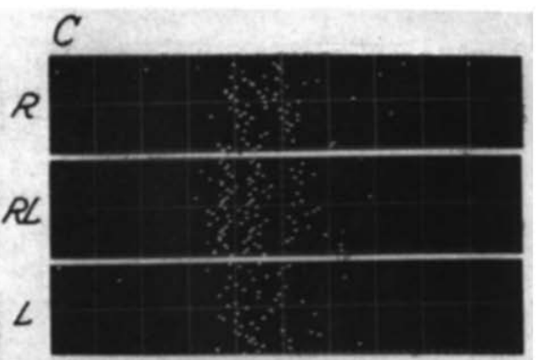
Bilateral summation differs from a direction comparator
Some recorded units responded to stimulation of either ear. Simultaneous stimulation produced a larger discharge than stimulation of one ear. This pattern is called bilateral summation, which combines input from the two sides into one response. Roeder pulsed the right ear, the left ear and both ears in turn. Each condition used matched 5 ms pulses.
Roeder presented matched 5 ms ultrasonic pulses to the right ear, the left ear or both. A summating unit near the ganglion midline gave a two-ear response that resembled a stronger stimulus to one ear alone. The unit responded to the combined input. Its response was set against that of a single ear stimulated alone.
Auditory input from both ears converges on these units. Steering needs side-specific information to reach motor output. A unit that responds to both ears may signal overall sound strength, and such a unit alone gives no side information. Convergence is one step, and steering needs a further step. A summating unit alone leaves the direction of a turn undecided.
Roeder (1966), Fig. 7(C). Responses to separate and simultaneous ear stimulation.
Roeder (1966), Fig. 1(A–B). Thoracic ganglia and recording coordinates.
Roeder (1966)
24
Notes:
• Some recorded units responded to stimulation of either ear, and simultaneous stimulation produced a larger discharge. **Bilateral summation** combines input from the two sides rather than necessarily comparing which side received the stronger signal.
• Roeder presented matched 5-ms ultrasonic pulses to the right ear, the left ear or both. A summating unit near the ganglion midline could produce a bilateral response resembling that evoked by stronger stimulation of one ear alone.
– A neuron that responds more when both ears are stimulated may encode overall input strength. It need not specify whether the source lies to the left or right. Roeder explicitly distinguished this observed summation from the still-undiscovered mechanism hypothesized to steer avoidance.
• Such activity establishes convergence of auditory inputs but is insufficient by itself to identify a directional difference detector. Steering requires a relationship between side-specific information and motor output. The proposed subtraction or temporal-precedence mechanisms were not directly resolved by this recorded summating response.
References:
Roeder KD (1966). Interneurons of the thoracic nerve cord activated by tympanic nerve fibres in noctuid moths. Journal of Insect Physiology 12: 1227-1244. https://doi.org/10.1016/0022-1910(66)90014-x
Figure: Roeder (1966), Fig. 7(C). Responses to separate and simultaneous ear stimulation.
Figure source: https://doi.org/10.1016/0022-1910(66)90014-x
Figure: Roeder (1966), Fig. 1(A–B). Thoracic ganglia and recording coordinates.
Figure source: https://doi.org/10.1016/0022-1910(66)90014-x

Slide 32
Summation and steering are separate questions
Roeder's matched pulses kept intensity constant across the three ear conditions. The recording coordinates place the units within the thoracic ganglia, where flight control circuits sit. Simultaneous stimulation of both ears was included. Each ear received the same stimulus pattern. The units sat near the midline of the ganglion.
The summating unit responded to both sides rather than to one. A unit's response to both ears leaves the stronger side unidentified. Steering needs side-specific information, and this unit lacks it. Roeder kept the summating response apart from the steering question. The unit's firing was measured in the same recordings.
The proposed steering mechanisms were not resolved by this summating response. Roeder distinguished this summation from the steering mechanism he had hypothesized, and the two ideas answer different questions about the same ganglion. Convergence of auditory inputs is one result, and a directional difference detector is a further one.
Roeder (1966), Fig. 7(C). Responses to separate and simultaneous ear stimulation.
Roeder (1966), Fig. 1(A–B). Thoracic ganglia and recording coordinates.
Roeder (1966)
24a
Notes:
• Summation and steering are separate questions.
• Explanation 1.
– Roeder's matched pulses kept intensity constant across the three ear conditions
– The recording coordinates place the units within the thoracic ganglia, where flight control circuits sit. Simultaneous stimulation of both ears was included. Each ear received the same stimulus pattern. The units sat near the midline of the ganglion.
• Explanation 2.
– The summating unit responded to both sides rather than to one
– A unit's response to both ears leaves the stronger side unidentified. Steering needs side-specific information, and this unit lacks it. Roeder kept the summating response apart from the steering question. The unit's firing was measured in the same recordings.
• Explanation 3.
– The proposed steering mechanisms were not resolved by this summating response
– Roeder distinguished this summation from the steering mechanism he had hypothesized, and the two ideas answer different questions about the same ganglion. Convergence of auditory inputs is one result, and a directional difference detector is a further one.
• Source.
– The figure and the measurements come from Roeder (1966).
– Each statement above comes from that paper's text, its figure legend or the speaker notes.
References:
Roeder KD (1966). Interneurons of the thoracic nerve cord activated by tympanic nerve fibres in noctuid moths. Journal of Insect Physiology 12: 1227-1244. https://doi.org/10.1016/0022-1910(66)90014-x

Slide 33
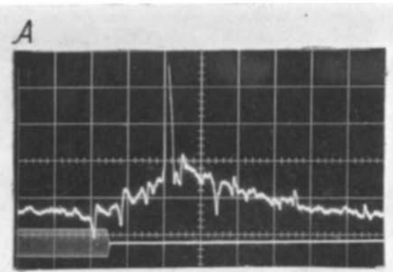
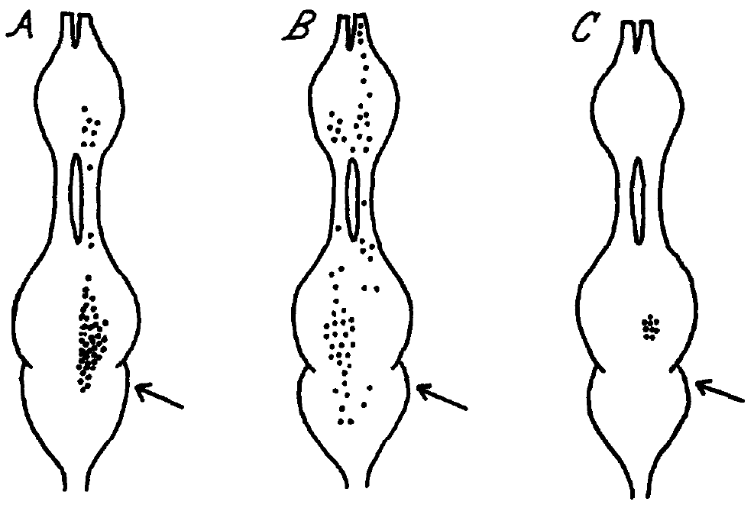
Pulse-marker units transform bursts into single events
A pulse-marker neuron usually generated one spike after an A1 burst, even when the burst held several spikes. The response kept the event and dropped much of the duration detail in the afferent train. A single spike marked the arrival of a sound. The output reduced many afferent spikes to one.
Roeder's recordings tied the response to groups of three or four A1 impulses spaced near 2 ms or less. For brief periods, the central unit could follow sound pulses repeated up to 40 times per second. Short intervals within the burst were the trigger. The recorded interval near 2 ms set the timing window for triggering.
The unit filters the burst rather than copying every afferent spike. Temporal summation, the buildup of excitation from closely spaced inputs, fits the triggering requirement. Closely spaced inputs add up to trigger the unit. The recordings left the synaptic current behind that buildup unmeasured. Pulse-marker output appeared in the recordings alongside the afferent bursts.
Roeder (1966), Fig. 6(A). Afferent bursts and pulse-marker spikes.
Roeder (1966), Fig. 8(A–C). Recorded afferent, relay and integrator locations.
Roeder (1966)
25
Notes:
• A **pulse-marker neuron** usually generated one spike after an A1 burst, even when the burst contained several spikes. This transformation reduces the detailed duration information in the afferent train while retaining the occurrence of an acoustic event.
• Roeder’s extracellular recordings associated the response with groups of three or four A1 impulses at intervals near 2 ms or less. For brief periods, the central unit could follow sound pulses repeated up to 40 times per second.
– The published location map represents where these response classes were encountered, not the complete morphology of each neuron. An A1 burst can contain information about duration and amplitude that is absent from the pulse-marker’s single output spike. The lost information may still exist in parallel pathways.
• The response supports a temporal filtering operation rather than a faithful copy of every afferent spike. **Temporal summation**, the accumulation of excitation from closely spaced inputs, is consistent with the triggering requirement. The recordings did not directly identify the underlying synaptic current or establish that this unit alone initiates escape.
References:
Roeder KD (1966). Interneurons of the thoracic nerve cord activated by tympanic nerve fibres in noctuid moths. Journal of Insect Physiology 12: 1227-1244. https://doi.org/10.1016/0022-1910(66)90014-x
Figure: Roeder (1966), Fig. 6(A). Afferent bursts and pulse-marker spikes.
Figure source: https://doi.org/10.1016/0022-1910(66)90014-x
Figure: Roeder (1966), Fig. 8(A–C). Recorded afferent, relay and integrator locations.
Figure source: https://doi.org/10.1016/0022-1910(66)90014-x

Slide 34
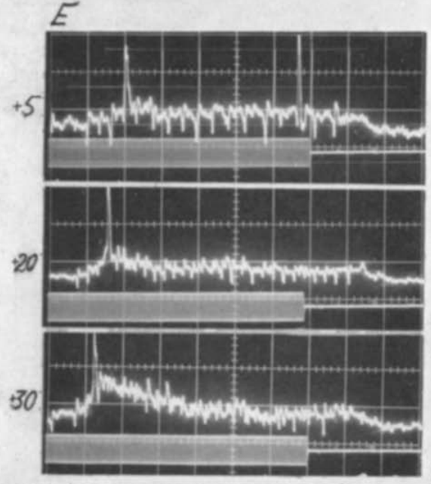
Pulse-marker recovery depends on the afferent pattern
The pulse-marker response depended on a preceding interval with reduced afferent activity. A long continuous A1 train often produced a single central spike, even when short intervals continued after that first response. The quiet period before a burst set the unit's readiness. The responding unit was recorded in the thoracic nerve cord.
With 30 to 40 ms stimuli, stronger pulses could evoke one pulse-marker spike. Weaker, irregular afferent bursts sometimes evoked more than one. Pulse-marker latency shortened from a variable value near 20 ms to about 6 ms as intensity rose. Latency and spike count both depended on the input's form. The stimuli lasted 30 to 40 ms in these tests.
A quiet interval may restore responsiveness in the unit. Recovery describes the observed ability to respond again after reduced input. Roeder did not measure the cellular recovery directly. The timing of the afferent burst decides how the unit responds to a long train. Those differences followed the form of the afferent input.
Roeder (1966), Fig. 8(A–C). Recorded afferent, relay and integrator locations.
Roeder (1966), Fig. 6(E). Pulse-marker latency and output at three intensities.
Roeder (1966)
26
Notes:
• The pulse-marker response depended on a preceding interval with reduced afferent activity. A long continuous A1 train often generated only one central spike, even when short interspike intervals continued after the initial response.
• With 30–40-ms stimuli, stronger pulses could elicit one pulse-marker spike, whereas weaker, irregular afferent bursts sometimes elicited more than one. Pulse-marker latency shortened from a variable value near 20 ms to about 6 ms with increasing intensity.
– The term recovery describes the observed ability to respond again after reduced input, rather than naming a specific membrane conductance. Roeder proposed that gaps among irregular weak-input bursts could permit resetting. The contrast remained based on extracellular timing rather than direct intracellular measurement of that reset.
• A quiet interval may permit the unit to become responsive again, but the responsible cellular recovery process was not measured directly. These results constrain a simple rule in which stronger or longer sound necessarily produces more central spikes. The temporal arrangement of the afferent burst influences its central transformation.
References:
Roeder KD (1966). Interneurons of the thoracic nerve cord activated by tympanic nerve fibres in noctuid moths. Journal of Insect Physiology 12: 1227-1244. https://doi.org/10.1016/0022-1910(66)90014-x
Figure: Roeder (1966), Fig. 6(E). Pulse-marker latency and output at three intensities.
Figure source: https://doi.org/10.1016/0022-1910(66)90014-x
Figure: Roeder (1966), Fig. 8(A–C). Recorded afferent, relay and integrator locations.
Figure source: https://doi.org/10.1016/0022-1910(66)90014-x

Slide 35
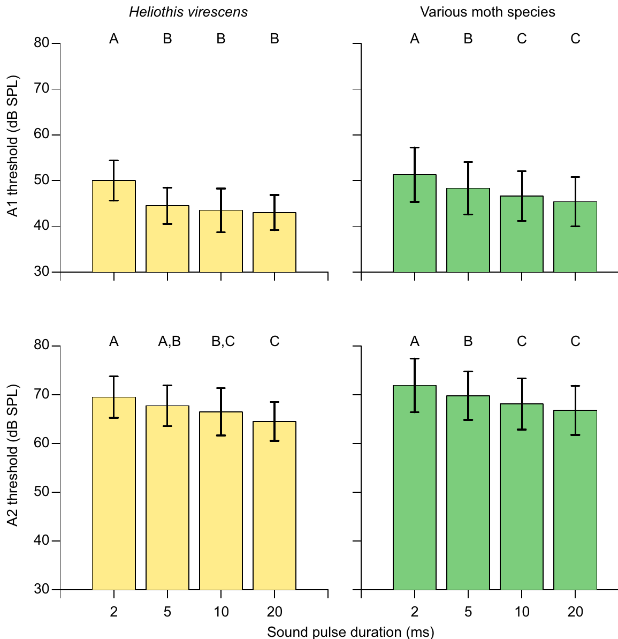
Longer sound pulses lower A1 and A2 thresholds
Gordon and ter Hofstede varied pulse duration while keeping the carrier at 50 kHz. The carrier is the oscillation rate inside each pulse, separate from how often pulses repeat. Only pulse duration changed across these threshold tests. The thresholds came from noctuid and erebid moths. The durations tested in this set were short pulses of a few milliseconds.
Both A1 and A2 generally needed stronger sound for shorter pulses. In Heliothis virescens, the mean A1 threshold for a 2 ms pulse was 5.5 dB higher than for a 5 ms pulse. The A2 threshold decreased more gradually across the tested durations than the A1 threshold did. The two cells respond to length in different ways.
Threshold depends on pulse duration. That dependence sets when a moth first detects a call. The result fits temporal integration, which adds up sound energy over the length of the pulse. The sensitivity change was measured at the level of the nerve. Which conductance produces the effect was not identified in this study.
Roeder & Treat (1957), Fig. 2. Published section through the ear and sensory attachment.
Gordon & ter Hofstede (2018), Fig. 5. Duration dependence of A1 and A2 thresholds.
Gordon & ter Hofstede (2018); Roeder & Treat (1957)
27
Notes:
• Gordon and ter Hofstede varied pulse duration while keeping the carrier at 50 kHz. The **carrier frequency** is the oscillation rate within each pulse, distinct from how often pulses repeat.
• Both A1 and A2 generally required stronger sound for shorter pulses. In _Heliothis virescens_, the mean A1 threshold for a 2-ms pulse exceeded that for a 5-ms pulse by 5.5 dB. A2 thresholds decreased more gradually across the tested durations.
– Stimulus amplitudes were calibrated as peak-equivalent sound pressure level, using a sinusoid with the same peak-to-peak amplitude as the brief pulse. That convention differs from a meter average over silence and sound together. It permits duration effects to be interpreted against an explicit measure of pulse amplitude.
• The dependence links stimulus duration to receptor sensitivity and changes when a moth can first detect a call. The result is consistent with temporal integration, but it does not identify the underlying conductance. A comparison of different bat calls must account for their duration as well as their level at the ear.
References:
Gordon SD, ter Hofstede HM (2018). The influence of bat echolocation call duration and timing on auditory encoding of predator distance in noctuoid moths. Journal of Experimental Biology 221: jeb171561. https://doi.org/10.1242/jeb.171561
Roeder KD, Treat AE (1957). Ultrasonic reception by the tympanic organ of noctuid moths. Journal of Experimental Zoology 134: 127-157. https://doi.org/10.1002/jez.1401340107
Figure: Gordon & ter Hofstede (2018), Fig. 5. Duration dependence of A1 and A2 thresholds.
Figure source: https://doi.org/10.1242/jeb.171561
Figure: Roeder & Treat (1957), Fig. 2. Published section through the ear and sensory attachment.
Figure source: https://doi.org/10.1002/jez.1401340107

Slide 36
Duration sets the threshold of each cell
Threshold changes with pulse duration in both cells. In moths the change fits temporal integration, a process that adds up sound energy across the pulse. Pulse duration was the only variable in the tested set. Gordon and ter Hofstede reported threshold differences in decibels. The contrast between the two cells adds the duration effect to that picture.
A1 showed the steeper change of the two cells. A2 thresholds fell more gradually across the durations. A1 is the more sensitive of the two cells at every duration. Heliothis virescens is one of the species in which this pattern was measured. Those thresholds are reported in dB SPL.
Bat calls differ in two cues, duration and level, that the ear must combine. A comparison of bat calls must account for their duration as well as their level at the ear. Duration and level together set which calls a moth can detect. The duration effect is measured at the nerve, not at the moth's behavior. The same measurements covered two moth families.
Roeder & Treat (1957), Fig. 2. Published section through the ear and sensory attachment.
Gordon & ter Hofstede (2018), Fig. 5. Duration dependence of A1 and A2 thresholds.
Gordon & ter Hofstede (2018)
27a
Notes:
• Duration sets the threshold of each cell.
• Explanation 1.
– Threshold changes with pulse duration in both cells
– In moths the change fits temporal integration, a process that adds up sound energy across the pulse. Pulse duration was the only variable in the tested set. Gordon and ter Hofstede reported threshold differences in decibels. The contrast between the two cells adds the duration effect to that picture.
• Explanation 2.
– A1 showed the steeper change of the two cells
– A2 thresholds fell more gradually across the durations. A1 is the more sensitive of the two cells at every duration. Heliothis virescens is one of the species in which this pattern was measured. Those thresholds are reported in dB SPL.
• Explanation 3.
– Bat calls differ in two cues, duration and level, that the ear must combine
– A comparison of bat calls must account for their duration as well as their level at the ear. Duration and level together set which calls a moth can detect. The duration effect is measured at the nerve, not at the moth's behavior. The same measurements covered two moth families.
• Source.
– The figure and the measurements come from Gordon & ter Hofstede (2018).
– Each statement above comes from that paper's text, its figure legend or the speaker notes.
References:
Gordon SD, ter Hofstede HM (2018). The influence of bat echolocation call duration and timing on auditory encoding of predator distance in noctuoid moths. Journal of Experimental Biology 221: jeb171561. https://doi.org/10.1242/jeb.171561

Slide 37
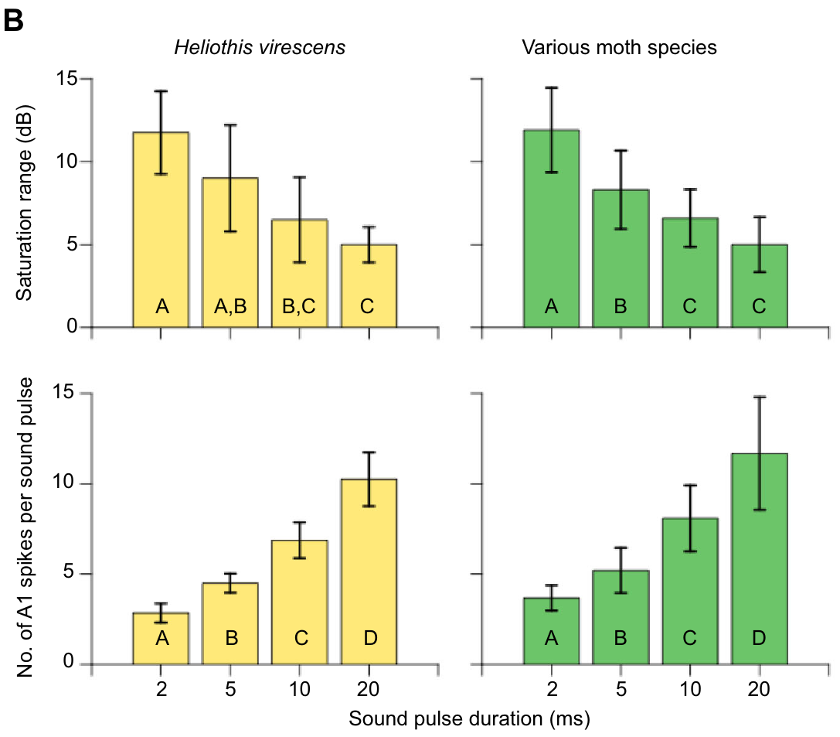
Short calls leave wider gaps in count-based intensity coding
The saturation range is the amplitude interval over which A1 spike count stays nearly unchanged before A2 begins responding. Gordon and ter Hofstede measured that interval separately from each cell's threshold. The interval describes the output range of one cell. Each cell's range was set relative to its own threshold.
For 2 ms pulses, the plateau held only 2 to 5 A1 spikes per pulse. For 20 ms pulses, plateau counts ranged from 8 to 18 spikes per pulse. Shorter pulses generally left a wider saturation range below the A2 threshold than longer pulses did. The plateau counts were larger for longer pulses.
A cell can detect a sound well and still code its intensity coarsely. Increasing sound level may add little through A1 spike count while A2 stays silent. These duration-dependent gaps constrain a continuously graded estimate of predator distance. The gaps are a property of the count code rather than of detection.
Roeder & Treat (1957), Fig. 2. Published section through the ear and sensory attachment.
Gordon & ter Hofstede (2018), Fig. 3(B). Saturation ranges and spike counts by duration.
Gordon & ter Hofstede (2018); Roeder & Treat (1957)
28
Notes:
• The **saturation range** is the amplitude interval over which A1 spike count remains nearly unchanged before A2 begins responding. Gordon and ter Hofstede measured that interval separately from each cell’s threshold.
• For 2-ms pulses, the plateau commonly contained only 2–5 A1 spikes per pulse. For 20-ms pulses, plateau counts ranged from 8–18 spikes per pulse. Shorter pulses generally left a wider saturation range below the A2 threshold.
– The bar plots summarize the range and count measures obtained from individual recordings. A higher number of spikes in a longer pulse is not evidence that the ear represents intensity more accurately at all levels; the relevant quantity is whether that count changes as intensity changes.
• More sensitive detection therefore does not guarantee fine intensity coding after detection. Increasing sound level may add little information through A1 spike count while A2 is still silent. These duration-dependent gaps constrain a continuously graded estimate of predator distance, without eliminating every possible cue available from timing or the opposite ear.
References:
Gordon SD, ter Hofstede HM (2018). The influence of bat echolocation call duration and timing on auditory encoding of predator distance in noctuoid moths. Journal of Experimental Biology 221: jeb171561. https://doi.org/10.1242/jeb.171561
Roeder KD, Treat AE (1957). Ultrasonic reception by the tympanic organ of noctuid moths. Journal of Experimental Zoology 134: 127-157. https://doi.org/10.1002/jez.1401340107
Figure: Gordon & ter Hofstede (2018), Fig. 3(B). Saturation ranges and spike counts by duration.
Figure source: https://doi.org/10.1242/jeb.171561
Figure: Roeder & Treat (1957), Fig. 2. Published section through the ear and sensory attachment.
Figure source: https://doi.org/10.1002/jez.1401340107

Slide 38
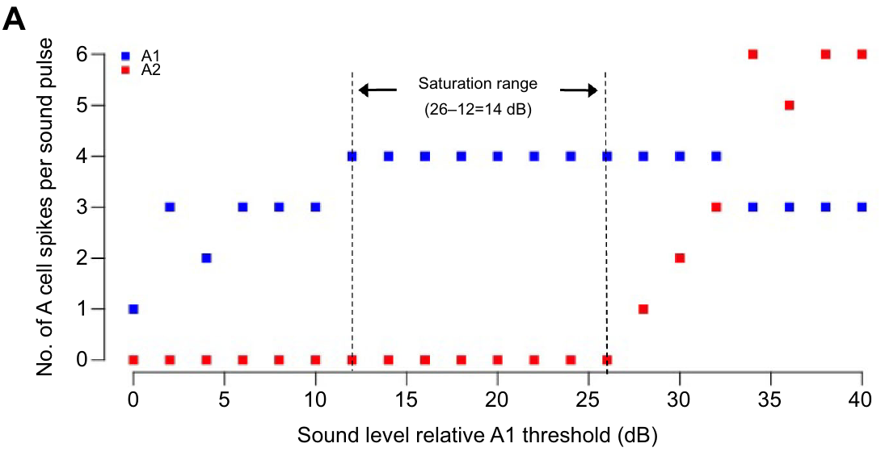
An A1 plateau can conceal increasing sound level
In the Raphia frater recording, a 2 ms, 50 kHz pulse elicited about four A1 spikes across a range of increasing amplitudes. A2 stayed silent through much of this plateau and joined only at higher levels. Each animal's A1 threshold set the reference for its plateau. The plateau appeared in a single moth's recording.
The experiment raised amplitude in steps while the nerve was recorded. The plateau comes from output to many controlled levels, one stimulus at each step. Each step was a separate controlled sound level, so the count belongs to the level at that step. The steps were set in calibrated increments.
An approaching bat grows louder without changing this count measure. Information about direction, stimulus history or a later A2 response may still arrive through other response features. The count is one readout among several. A later A2 response is one such feature. The authors treated the count as the selected measure of output.
Gordon & ter Hofstede (2018), Fig. 3(A). A1 saturation before A2 recruitment in Raphia frater.
Roeder & Treat (1957), Fig. 2. Published section through the ear and sensory attachment.
Gordon & ter Hofstede (2018); Roeder & Treat (1957)
29
Notes:
• In the _Raphia frater_ recording, a 2-ms, 50-kHz pulse elicited about four A1 spikes across an interval of increasing sound amplitudes. A2 remained silent during much of this plateau and was recruited only at higher levels.
• The experiment increased amplitude systematically while the auditory nerve was recorded. The plateau therefore reflects repeated neural output to different controlled sound levels, rather than a constant input being measured repeatedly.
– The figure labels the saturation interval relative to the individual A1 threshold. Relative dB values should not be confused with absolute sound pressure levels at the ear. The particular plateau belongs to this preparation, while the multi-species tests establish how commonly the pattern occurred.
• An approaching bat can become acoustically stronger without changing this selected output measure. The limitation concerns the count code within that range; it does not mean that the moth fails to hear the bat. Information about direction, stimulus history or a later A2 response may remain available through other response features.
References:
Gordon SD, ter Hofstede HM (2018). The influence of bat echolocation call duration and timing on auditory encoding of predator distance in noctuoid moths. Journal of Experimental Biology 221: jeb171561. https://doi.org/10.1242/jeb.171561
Roeder KD, Treat AE (1957). Ultrasonic reception by the tympanic organ of noctuid moths. Journal of Experimental Zoology 134: 127-157. https://doi.org/10.1002/jez.1401340107
Figure: Gordon & ter Hofstede (2018), Fig. 3(A). A1 saturation before A2 recruitment in Raphia frater.
Figure source: https://doi.org/10.1242/jeb.171561
Figure: Roeder & Treat (1957), Fig. 2. Published section through the ear and sensory attachment.
Figure source: https://doi.org/10.1002/jez.1401340107

Slide 39
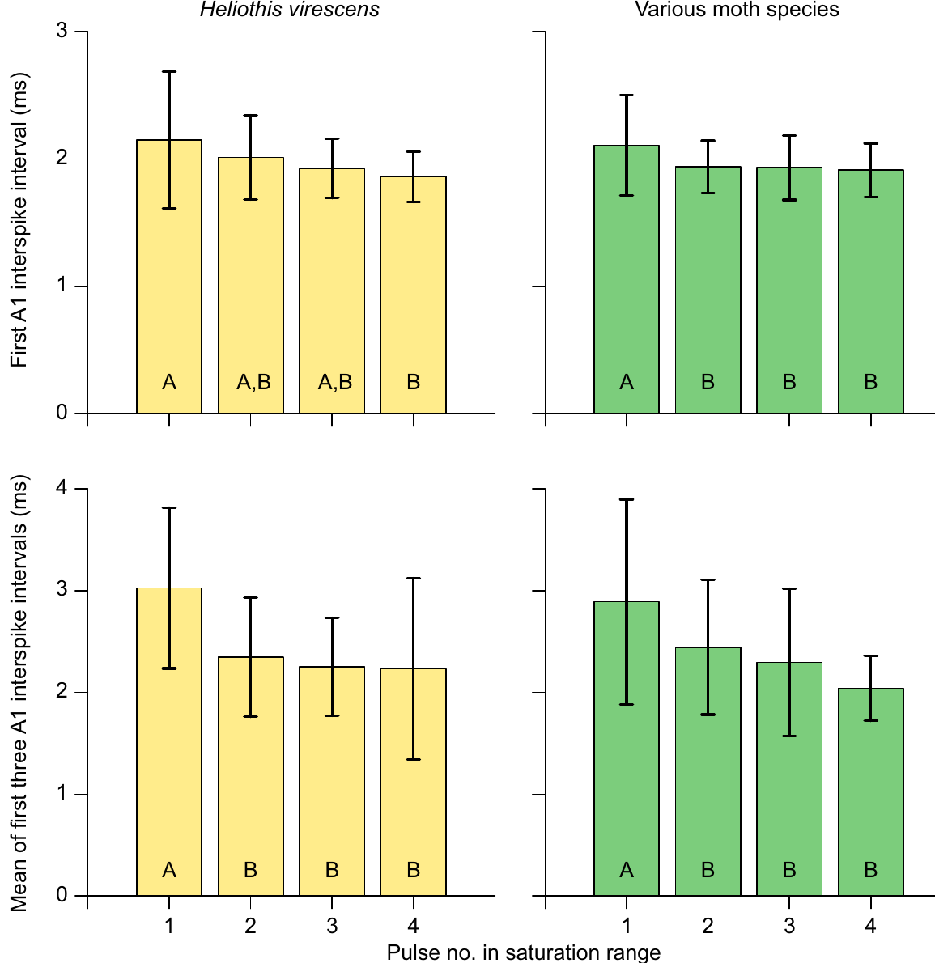
Spike intervals change little within the saturation range
An interspike interval is the time between successive action potentials. It can carry information even when spike count stays the same, because the same number of spikes can sit at different times. Two bursts with the same count can differ in their internal spacing. The spacing gives a second readout of the same burst.
Gordon and ter Hofstede examined A1 intervals within the short-pulse saturation range. Apart from a longer interval at the lowest sampled amplitude, the first interval and the mean of the first few intervals changed little as sound level rose. Intervals were examined only within that saturation range. The lowest amplitude produced the one larger interval.
Timing can mark a meaningful event even after the response saturates. Interval timing offers a continuous intensity code in that range, as an alternative to spike count. Tightly grouped bursts stand out from spontaneous isolated spikes. Timing identifies an event without grading every stronger amplitude. Spontaneous isolated spikes lacked the tight spacing of the bursts.
Roeder & Treat (1957), Fig. 2. Published section through the ear and sensory attachment.
Gordon & ter Hofstede (2018), Fig. 4. Interspike intervals within the saturation range.
Gordon & ter Hofstede (2018); Roeder & Treat (1957)
30
Notes:
• An **interspike interval** is the time between successive action potentials. It can carry information even when spike count is unchanged, because the same number of spikes can be distributed differently in time.
• Gordon and ter Hofstede examined A1 intervals during the short-pulse saturation range. Apart from a larger interval at the lowest sampled amplitude, the first interval and the mean of the initial intervals changed little as sound level increased.
– The experiment tests two different claims about timing: whether spikes form a burst, and whether the burst’s internal spacing encodes additional intensity differences. A reliable short interval can contribute to central excitation even if it changes little over the plateau.
• This comparison constrains interval timing as an alternative continuous intensity code in that range. It does not negate Roeder’s evidence that tightly grouped bursts differ from spontaneous isolated spikes or adapted tone responses. Timing can identify a meaningful event without distinguishing every stronger amplitude once the response is saturated.
References:
Gordon SD, ter Hofstede HM (2018). The influence of bat echolocation call duration and timing on auditory encoding of predator distance in noctuoid moths. Journal of Experimental Biology 221: jeb171561. https://doi.org/10.1242/jeb.171561
Roeder KD, Treat AE (1957). Ultrasonic reception by the tympanic organ of noctuid moths. Journal of Experimental Zoology 134: 127-157. https://doi.org/10.1002/jez.1401340107
Figure: Gordon & ter Hofstede (2018), Fig. 4. Interspike intervals within the saturation range.
Figure source: https://doi.org/10.1242/jeb.171561
Figure: Roeder & Treat (1957), Fig. 2. Published section through the ear and sensory attachment.
Figure source: https://doi.org/10.1002/jez.1401340107

Slide 40
Interval timing is a second intensity code
The experiment tested two claims about timing. One asked whether spikes form a burst. The other asked whether spacing inside the burst encodes extra intensity differences. The question was whether timing carries intensity information once spike count saturates. Gordon and ter Hofstede examined both claims in A1 recordings. The two claims were tested in the same recordings.
A reliable short interval can add to central excitation, even when it changes little across the plateau. Those intervals came from the short-pulse condition, where spike count saturated. Roeder's earlier recordings showed that tight bursts differ from isolated spikes. That range is where spike count stayed flat across levels. The plateau is the setting for these interval measures.
Pooled curves can look smoother than any single animal's response. One individual's plateau can occur at a different relative amplitude from another's. Spacing carries timing information that the spike count omits. Each moth's receptor output sets its own plateau. The meaningful event here is the burst itself. Burst spacing and spike count are separate readouts.
Roeder & Treat (1957), Fig. 2. Published section through the ear and sensory attachment.
Gordon & ter Hofstede (2018), Fig. 4. Interspike intervals within the saturation range.
Gordon & ter Hofstede (2018)
30a
Notes:
• Interval timing is a second intensity code.
• Explanation 1.
– The experiment tested two claims about timing
– One asked whether spikes form a burst. The other asked whether spacing inside the burst encodes extra intensity differences. The question was whether timing carries intensity information once spike count saturates. Gordon and ter Hofstede examined both claims in A1 recordings. The two claims were tested in the same recordings.
• Explanation 2.
– A reliable short interval can add to central excitation, even when it changes little across the plateau
– Those intervals came from the short-pulse condition, where spike count saturated. Roeder's earlier recordings showed that tight bursts differ from isolated spikes. That range is where spike count stayed flat across levels. The plateau is the setting for these interval measures.
• Explanation 3.
– Pooled curves can look smoother than any single animal's response
– One individual's plateau can occur at a different relative amplitude from another's. Spacing carries timing information that the spike count omits. Each moth's receptor output sets its own plateau. The meaningful event here is the burst itself. Burst spacing and spike count are separate readouts.
• Source.
– The figure and the measurements come from Gordon & ter Hofstede (2018).
– Each statement above comes from that paper's text, its figure legend or the speaker notes.
References:
Gordon SD, ter Hofstede HM (2018). The influence of bat echolocation call duration and timing on auditory encoding of predator distance in noctuoid moths. Journal of Experimental Biology 221: jeb171561. https://doi.org/10.1242/jeb.171561

Slide 41
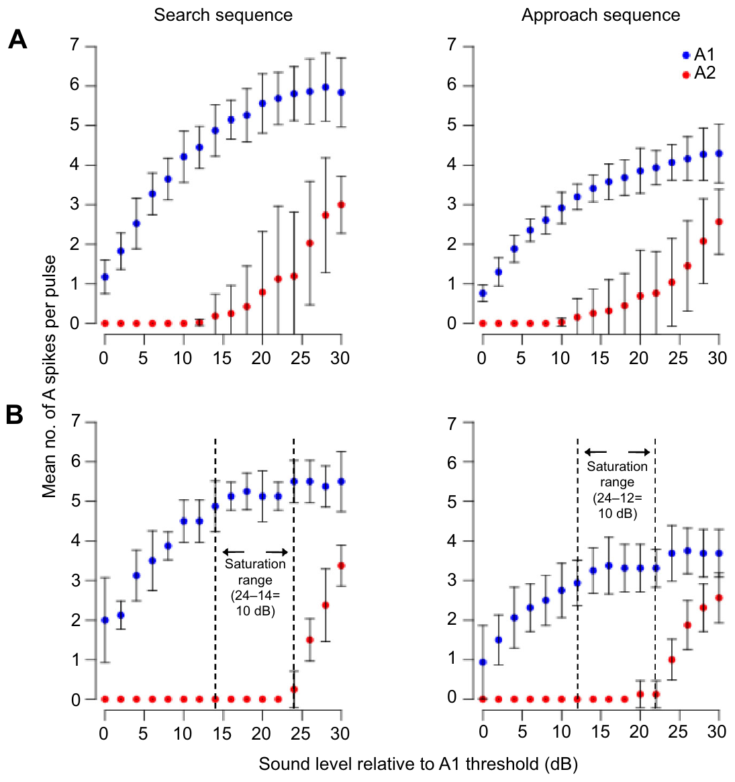
Bat-like pulse sequences preserve individual coding gaps
Gordon and ter Hofstede compared sequences modeled on searching bats and approaching bats. Search-like stimuli used 5 ms pulses every 75 ms. Approach-like stimuli used 2.5 ms pulses every 37.5 ms. The two patterns approximate the timing of real bat calls. The stimuli were sequences rather than single pulses. Search-like timing had longer intervals between pulses than approach-like timing.
Both sequences had the same duty cycle, the fraction of time occupied by sound. They differed in pulse duration and repetition rate. A1 and A2 output was measured while the amplitude of the whole sequence rose. Each level produced a full pulse train rather than a single pulse. The duty cycle held the sound fraction constant.
Averaged responses looked smoothly graded. Individual moths retained A1 saturation ranges of 4 to 12 dB before A2 joined, so averaging hid some coding gaps within each animal. Each moth receives its own receptor output, not an average across many individuals. The sequences approximate bat timing without copying every frequency sweep.
Roeder & Treat (1957), Fig. 2. Published section through the ear and sensory attachment.
Gordon & ter Hofstede (2018), Fig. 6(A–B). Search- and approach-like pulse-sequence responses.
Gordon & ter Hofstede (2018); Roeder & Treat (1957)
31
Notes:
• Gordon and ter Hofstede compared sequences modeled on searching and approaching bats. Search-like stimuli used 5-ms pulses every 75 ms, whereas approach-like stimuli used 2.5-ms pulses every 37.5 ms.
• The sequences had the same duty cycle, the fraction of time occupied by sound, while differing in pulse duration and repetition rate. A1 and A2 output was measured as the amplitude of the entire sequence increased.
– A moth receives its own receptor output rather than the average across many individuals. One individual’s plateau can occur at a different relative amplitude from another’s, making the pooled curve smoother than any one receptor response. The matching duty cycle controls one aspect of the acoustic sequence while deliberately varying others.
• Averaged responses could appear smoothly graded, but individual moths retained A1 saturation ranges of 4–12 dB before A2 recruitment. Population averaging therefore concealed some within-animal coding gaps. The sequences approximate bat timing; they do not reproduce every natural frequency sweep, directional change or amplitude trajectory of an attack.
References:
Gordon SD, ter Hofstede HM (2018). The influence of bat echolocation call duration and timing on auditory encoding of predator distance in noctuoid moths. Journal of Experimental Biology 221: jeb171561. https://doi.org/10.1242/jeb.171561
Roeder KD, Treat AE (1957). Ultrasonic reception by the tympanic organ of noctuid moths. Journal of Experimental Zoology 134: 127-157. https://doi.org/10.1002/jez.1401340107
Figure: Gordon & ter Hofstede (2018), Fig. 6(A–B). Search- and approach-like pulse-sequence responses.
Figure source: https://doi.org/10.1242/jeb.171561
Figure: Roeder & Treat (1957), Fig. 2. Published section through the ear and sensory attachment.
Figure source: https://doi.org/10.1002/jez.1401340107

Slide 42
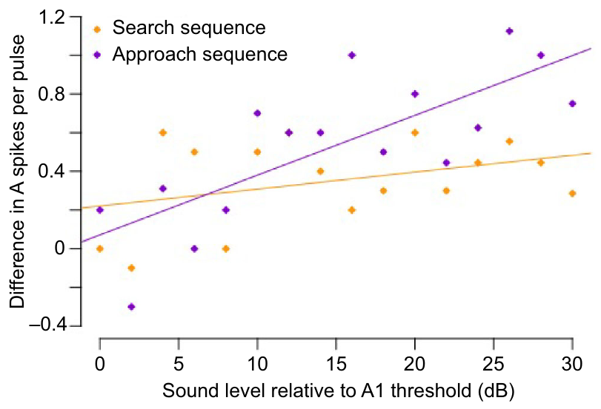
Approach-like sequences adapt more at higher amplitudes
The effect of repeated pulses depended on both timing and sound level. Gordon and ter Hofstede compared A1 spikes after the first and last pulses in each search-like and approach-like sequence. Those two pulses were set at the same sequence amplitude. This design isolated the effect of repetition itself. The decline was measured as spikes per pulse.
Search-like sequences showed little systematic decline, even at high levels. In approach-like sequences, stronger stimulation produced fewer spikes near the end. The mean first-to-last drop exceeded half a spike per pulse only above 10 dB relative to A1 threshold. Decline appeared only when the sound was loud enough. The 10 dB threshold is measured relative to each moth's A1 threshold.
Adaptation depends on the input pattern and on the receptor's operating range. These measurements cover the peripheral nerve, so the effect on an individual moth's flight is a separate question. The sequence pattern determines whether adaptation appears at all. Repeated sound produces adaptation only in some patterns. Flight consequences lay outside these experiments.
Gordon & ter Hofstede (2018), Fig. 7. Adaptation within search- and approach-like sequences.
Roeder & Treat (1957), Fig. 2. Published section through the ear and sensory attachment.
Gordon & ter Hofstede (2018); Roeder & Treat (1957)
32
Notes:
• The effect of repeated pulses depended on both timing and sound level. Gordon and ter Hofstede compared A1 spikes after the first and last pulse in each search-like or approach-like sequence.
• Search-like sequences showed little systematic decline, even at high levels. In approach-like sequences, stronger stimulation produced fewer spikes near the sequence’s end; the mean first-to-last difference exceeded half a spike per pulse only above 10 dB relative to A1 threshold.
– The first and last pulses are compared at the same sequence amplitude. The decline therefore reflects stimulus history within the sequence, rather than a planned reduction in acoustic intensity. The authors did not test terminal-buzz repetition rates in this experiment.
• Adaptation therefore cannot be assumed simply because sound repeats. Its expression depends on the input pattern and receptor operating range. These measurements concern the peripheral nerve; they do not identify a central state change or establish how the same decline alters an individual moth’s flight.
References:
Gordon SD, ter Hofstede HM (2018). The influence of bat echolocation call duration and timing on auditory encoding of predator distance in noctuoid moths. Journal of Experimental Biology 221: jeb171561. https://doi.org/10.1242/jeb.171561
Roeder KD, Treat AE (1957). Ultrasonic reception by the tympanic organ of noctuid moths. Journal of Experimental Zoology 134: 127-157. https://doi.org/10.1002/jez.1401340107
Figure: Gordon & ter Hofstede (2018), Fig. 7. Adaptation within search- and approach-like sequences.
Figure source: https://doi.org/10.1242/jeb.171561
Figure: Roeder & Treat (1957), Fig. 2. Published section through the ear and sensory attachment.
Figure source: https://doi.org/10.1002/jez.1401340107

Slide 43
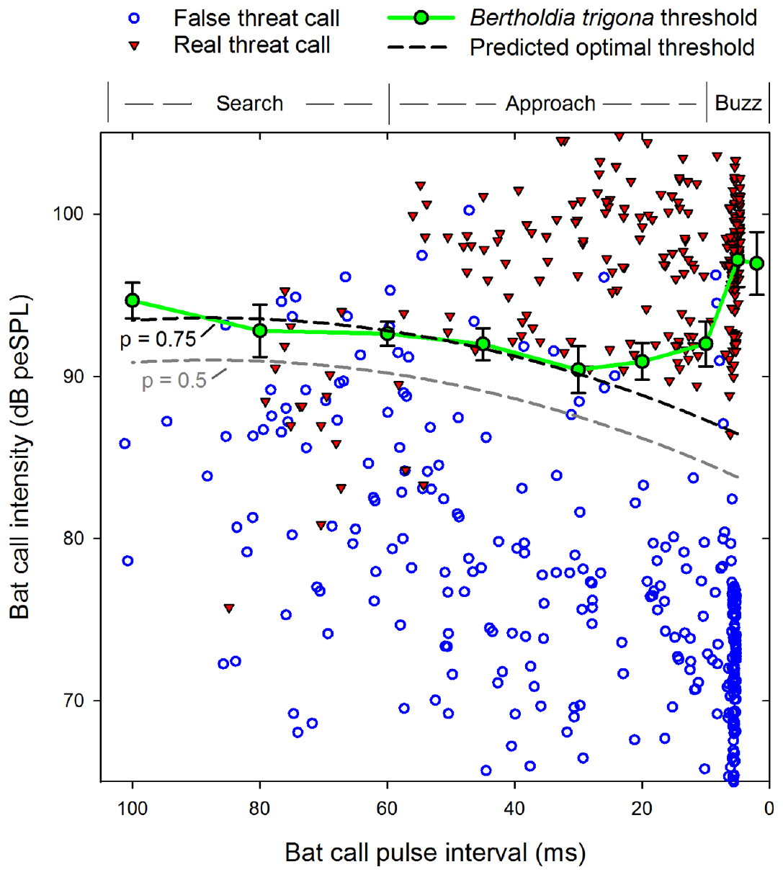
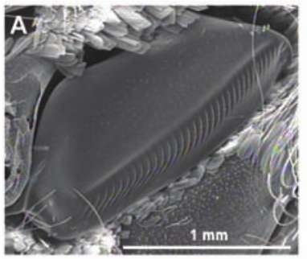
Clicking thresholds depend on bat-like pulse timing
The tiger moth Bertholdia trigona produces defensive ultrasonic clicks with a tymbal. A tymbal is a sound-producing structure, distinct from the tympanum that receives sound. Corcoran and colleagues measured the input levels that triggered clicking in the laboratory. The clicks are the moth's defensive output. The defensive output is distinct from the hearing organ.
In laboratory playbacks, 40 kHz pulses of 2 ms duration rose in intensity from 70 to 120 dB SPL. Pulse intervals varied to match stages of bat echolocation, and the first moth click defined the behavioral threshold. The playbacks stopped once clicking began. Silent intervals separated the presentations. Thresholds were compared across the interval conditions.
The lowest clicking thresholds occurred at intervals of 20 to 30 ms, which resemble late approach calls. Search-like and very rapid terminal timing needed louder sound. This curve records behavior rather than receptor sensitivity. The thresholds measure the defensive response, not the sensory cells alone. Louder sound was needed for clicks when the calls came at very rapid rates.
Corcoran et al. (2009), Fig. 1(A). Sound-producing tymbal; scale bar 1 mm.
Corcoran et al. (2013), Fig. 4. Measured clicking thresholds and real/false threat calls.
Corcoran et al. (2013); Corcoran et al. (2009)
33
Notes:
• The tiger moth _Bertholdia trigona_ produces defensive ultrasonic clicks using a **tymbal**, a sound-producing structure distinct from the tympanum that receives sound. Corcoran and colleagues measured the input levels required to trigger clicking.
• Laboratory playbacks used 40-kHz pulses of 2-ms duration, with intensity rising from 70 to 120 dB SPL. Pulse intervals were varied to represent different stages of bat echolocation, and the first moth click defined the behavioral threshold.
– The playbacks were stopped when clicking began, and silent intervals separated presentations. This reduces contamination by a continuing defensive response from the preceding test. The tymbal photograph identifies the output organ, while the threshold experiment concerns the sensory conditions that activate it.
• The lowest clicking thresholds occurred at intervals of 20–30 ms, resembling late approach calls. Search-like and very rapid terminal timing required greater sound levels. This is a behavioral response curve rather than a receptor audiogram: hearing a pulse and deciding to emit a defensive signal are different measured events.
References:
Corcoran AJ, Wagner RD, Conner WE (2013). Optimal Predator Risk Assessment by the Sonar-Jamming Arctiine Moth Bertholdia trigona. PLoS ONE 8: e63609. https://doi.org/10.1371/journal.pone.0063609
Corcoran AJ, Barber JR, Conner WE (2009). Tiger Moth Jams Bat Sonar. Science 325: 325-327. https://doi.org/10.1126/science.1174096
Figure: Corcoran et al. (2013), Fig. 4. Measured clicking thresholds and real/false threat calls.
Figure source: https://doi.org/10.1371/journal.pone.0063609
Figure: Corcoran et al. (2009), Fig. 1(A). Sound-producing tymbal; scale bar 1 mm.
Figure source: https://doi.org/10.1126/science.1174096

Slide 44
Tiger-moth clicks respond to call timing
The clicking thresholds came from a laboratory playback of pulses with set intervals. Each interval represented a stage of bat echolocation. Playback intensity rose across the tested range. The thresholds came from the same playback design across intervals, with silent gaps between presentations. The first click is the measured endpoint of each playback.
This definition ties the threshold to the defensive output rather than to the sensory response alone. The threshold measures an action, not a receptor. Each click response was checked against the interval it followed. Clicks were scored as the moth's defensive output, not as its hearing. The sensory cells were never tested in isolation.
Rapid terminal timing required sound at higher levels than late approach timing did. Late approach calls at 20 to 30 ms triggered clicking at the lowest sound levels. The clicks themselves are the output that the threshold tracks. Hearing a pulse and emitting a defensive click are different measured events.
Corcoran et al. (2009), Fig. 1(A). Sound-producing tymbal; scale bar 1 mm.
Corcoran et al. (2013), Fig. 4. Measured clicking thresholds and real/false threat calls.
Corcoran et al. (2013)
33a
Notes:
• Tiger-moth clicks respond to call timing.
• Explanation 1.
– The clicking thresholds came from a laboratory playback of pulses with set intervals
– Each interval represented a stage of bat echolocation. Playback intensity rose across the tested range. The thresholds came from the same playback design across intervals, with silent gaps between presentations. The first click is the measured endpoint of each playback.
• Explanation 2.
– This definition ties the threshold to the defensive output rather than to the sensory response alone
– The threshold measures an action, not a receptor. Each click response was checked against the interval it followed. Clicks were scored as the moth's defensive output, not as its hearing. The sensory cells were never tested in isolation.
• Explanation 3.
– Rapid terminal timing required sound at higher levels than late approach timing did
– Late approach calls at 20 to 30 ms triggered clicking at the lowest sound levels. The clicks themselves are the output that the threshold tracks. Hearing a pulse and emitting a defensive click are different measured events.
• Source.
– The figure and the measurements come from Corcoran et al. (2013).
– Each statement above comes from that paper's text, its figure legend or the speaker notes.
References:
Corcoran AJ, Wagner RD, Conner WE (2013). Optimal Predator Risk Assessment by the Sonar-Jamming Arctiine Moth Bertholdia trigona. PLoS ONE 8: e63609. https://doi.org/10.1371/journal.pone.0063609

Slide 45
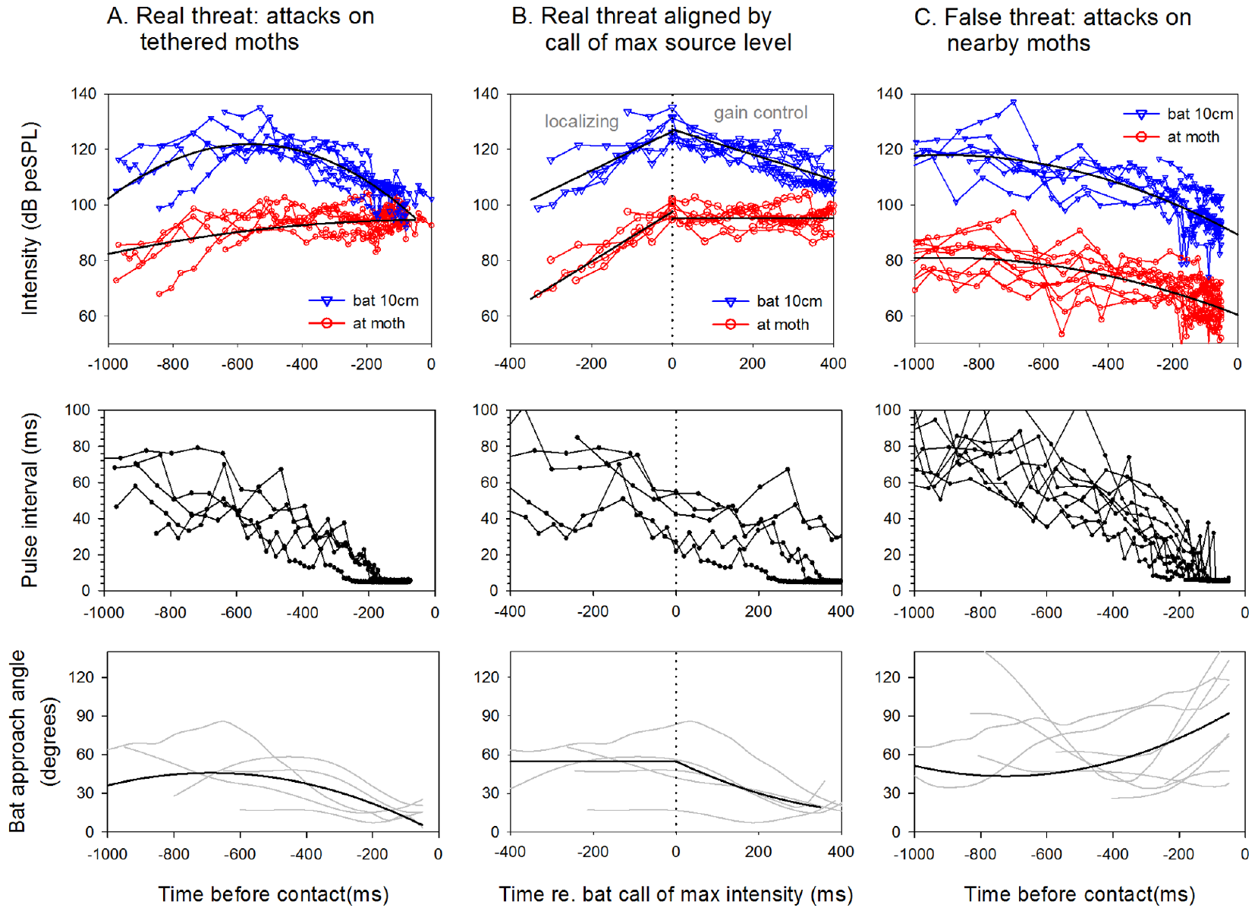
Targeted attacks differ acoustically from nearby attacks
A moth can hear a bat that is attacking another insect. Corcoran and colleagues defined a real threat as an attack on the focal moth. A false threat was an attack on a neighboring free-flying moth. A close bat can stay weak at the focal moth if its beam points elsewhere. The moth must judge the threat from the signal it receives.
Synchronized infrared video and ultrasonic recordings estimated call pressure at the focal moth while reconstructing bat position. During real attacks, received intensity usually rose and then leveled off late in the approach. Beam orientation, distance and source-level changes all influence the received signal. Each of these changes the level at the moth.
During false threats, intensity at the non-target moth tended to fall. Pulse intervals shortened in both cases, so call rate by itself gave no clue to the victim. The contrast suggests moths combine timing with received level. Both cues differ between real and false threats. Field amplitudes used peak-equivalent sound pressure level, or peSPL.
Corcoran et al. (2013), Fig. 5(A–C). Call levels and flight parameters during real/false threats.
Corcoran et al. (2013)
34
Notes:
• A moth can hear a bat that is attacking another insect. Corcoran and colleagues defined a **real threat** as an attack on the focal moth and a **false threat** as an attack on a neighboring free-flying moth.
• Synchronized infrared video and ultrasonic recordings estimated call pressure at the focal moth while reconstructing bat position. During real attacks, received intensity generally increased before leveling late in the approach. During false threats, intensity at the non-target moth tended to decrease.
– The bat’s emitted intensity and the intensity arriving at a moth are separate quantities. Beam orientation, distance and source-level changes all influence the received signal. The investigators therefore estimated pressure at the insect rather than relying only on the bat’s call timing.
• Pulse intervals shortened in both circumstances, so increasing call rate alone did not uniquely identify the victim. The contrast supports combined use of timing and received level. Field amplitudes used peak-equivalent sound pressure level (peSPL), matched to the peak amplitude of a reference sinusoid. The field comparison establishes available cues, but it does not directly record the neural computation that differentiates the two situations.
References:
Corcoran AJ, Wagner RD, Conner WE (2013). Optimal Predator Risk Assessment by the Sonar-Jamming Arctiine Moth Bertholdia trigona. PLoS ONE 8: e63609. https://doi.org/10.1371/journal.pone.0063609
Figure: Corcoran et al. (2013), Fig. 5(A–C). Call levels and flight parameters during real/false threats.
Figure source: https://doi.org/10.1371/journal.pone.0063609

Slide 46
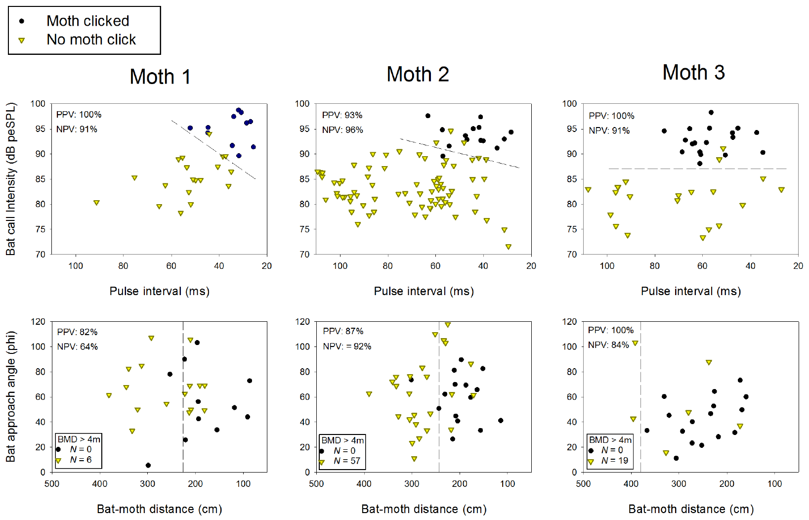
Field clicking begins during early-to-middle approach
Corcoran and colleagues recorded free-flying bats passing tethered Bertholdia trigona. They compared passes that triggered clicks with passes that stayed silent. Tethering constrained the moths' flight, but they could still hear and click. The tethered moths could still produce clicks. The recordings matched each pass to whether a click followed.
Clicking usually began during early to middle approach, when bat pulse intervals were 25 to 60 ms. Sound level at the moth separated clicking from silent passes more consistently than bat distance or approach angle alone. Level was the better guide to the trigger. Distance alone did not sort the passes.
Acoustic input from the bat sets when the defensive output begins. Whether the bat aims its calls at the moth also changes the timing. The bat's direction and the sound it receives both matter to the moth's response. Timing depends on what the insect receives acoustically. The bat's approach angle was also measured in these recordings.
Corcoran et al. (2013), Fig. 6, first two rows. Clicking versus silent passes by acoustic and distance cues.
Corcoran et al. (2013)
35
Notes:
• Corcoran and colleagues recorded free-flying bats passing tethered _Bertholdia trigona_ and compared encounters that elicited clicks with those that did not. The focal moths could hear and click, but their flight trajectories were constrained.
• Clicking usually began during early-to-middle approach, with bat pulse intervals of 25–60 ms. Sound level at the moth discriminated clicking from silent passes more consistently than bat distance or flight approach angle alone.
– A close bat may remain acoustically weak at the focal moth if its beam points elsewhere. Conversely, a directed sequence can identify an escalating threat before a major change in flight approach angle. The laboratory threshold test and field observations address complementary input–output conditions.
• These observations link natural acoustic input with the onset of a defensive output. They do not establish that tethered and freely flying moths respond identically, or that a fixed distance determines clicking. Timing depends on what the insect receives acoustically, including whether the bat directs its calls toward it.
References:
Corcoran AJ, Wagner RD, Conner WE (2013). Optimal Predator Risk Assessment by the Sonar-Jamming Arctiine Moth Bertholdia trigona. PLoS ONE 8: e63609. https://doi.org/10.1371/journal.pone.0063609
Figure: Corcoran et al. (2013), Fig. 6, first two rows. Clicking versus silent passes by acoustic and distance cues.
Figure source: https://doi.org/10.1371/journal.pone.0063609

Slide 47
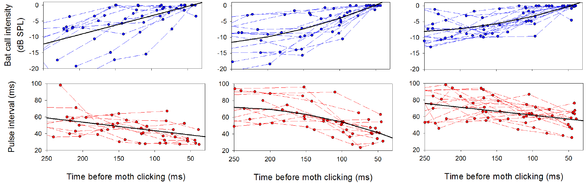
Rising call levels precede defensive clicking
During the 250 ms before defensive clicks, bat calls rose in received intensity. Their pulse intervals also became slightly shorter. Corcoran and colleagues measured both changes relative to clicking onset. The changes occurred before the moth's defensive response. The measurements used the bat calls recorded at the moth. The bat's calls were measured at the moth's position.
This acoustic combination fits a bat detecting and targeting the moth. In real attacks, received intensity could level off near 95 dB peSPL while the bat lowered its source output during the approach. The level at the moth followed both the bat's distance and its output. Both factors changed the signal at the same time.
A bat that emits less can still deliver a stronger signal to its prey. Distance and the bat's source output together set the signal that reaches the moth's ear. The defense is timed to that changing signal. The timing tracks the signal rather than the bat's output alone. Clicks followed that rise in received level.
Corcoran et al. (2013), Fig. 6, last two rows. Call-level and pulse-interval changes preceding clicks.
Corcoran et al. (2013)
36
Notes:
• During the interval preceding defensive clicks, bat calls increased in received intensity while their pulse intervals became slightly shorter. Corcoran and colleagues measured these changes over the 250 ms before clicking onset.
• The acoustic combination is consistent with a bat detecting and targeting the moth. In real attacks, received intensity could subsequently plateau near 95 dB peSPL while the bat reduced its source output as it approached.
– Call-level and interval changes were measured relative to clicking onset. The claim concerns changes before a measured behavioral event. Selection for efficient timing was proposed by the authors; the field records alone do not demonstrate the evolutionary process that produced it.
• A decreasing emitted level therefore need not mean decreasing threat at the prey. Geometry and source regulation jointly shape the signal that reaches the ear. The association supports threat-sensitive timing of the defense, but the study did not establish the exact receptor or interneuron computation that triggers the first click.
References:
Corcoran AJ, Wagner RD, Conner WE (2013). Optimal Predator Risk Assessment by the Sonar-Jamming Arctiine Moth Bertholdia trigona. PLoS ONE 8: e63609. https://doi.org/10.1371/journal.pone.0063609
Figure: Corcoran et al. (2013), Fig. 6, last two rows. Call-level and pulse-interval changes preceding clicks.
Figure source: https://doi.org/10.1371/journal.pone.0063609

Slide 48
Bats raise intensity before a moth clicks
Corcoran and colleagues measured the bat's call levels over the 250 ms before clicking began. Those levels increased before the click. The claim concerns changes that come before a measured behavioral event. Both changes preceded the defensive output in the recorded encounters. Received level was measured at the moth in each encounter.
The bat's pulse intervals shortened slightly during the same interval. Shorter intervals and rising received intensity together marked the approach that preceded the moth's defense. The timing change was small next to the level change. Both measurements came from the same calls. Received level and interval are measured against the same clicking onset.
The authors proposed that selection favored efficient timing of the bat's calls. Field records alone leave that evolutionary history untested. The first click was the behavioral event used to time these changes. The proposal is a hypothesis about evolution, not a measured result. The proposal explains the timing pattern as a product of selection.
Corcoran et al. (2013), Fig. 6, last two rows. Call-level and pulse-interval changes preceding clicks.
Corcoran et al. (2013)
36a
Notes:
• Bats raise intensity before a moth clicks.
• Explanation 1.
– Corcoran and colleagues measured the bat's call levels over the 250 ms before clicking began
– Those levels increased before the click. The claim concerns changes that come before a measured behavioral event. Both changes preceded the defensive output in the recorded encounters. Received level was measured at the moth in each encounter.
• Explanation 2.
– The bat's pulse intervals shortened slightly during the same interval
– Shorter intervals and rising received intensity together marked the approach that preceded the moth's defense. The timing change was small next to the level change. Both measurements came from the same calls. Received level and interval are measured against the same clicking onset.
• Explanation 3.
– The authors proposed that selection favored efficient timing of the bat's calls
– Field records alone leave that evolutionary history untested. The first click was the behavioral event used to time these changes. The proposal is a hypothesis about evolution, not a measured result. The proposal explains the timing pattern as a product of selection.
• Source.
– The figure and the measurements come from Corcoran et al. (2013).
– Each statement above comes from that paper's text, its figure legend or the speaker notes.
References:
Corcoran AJ, Wagner RD, Conner WE (2013). Optimal Predator Risk Assessment by the Sonar-Jamming Arctiine Moth Bertholdia trigona. PLoS ONE 8: e63609. https://doi.org/10.1371/journal.pone.0063609

Slide 49
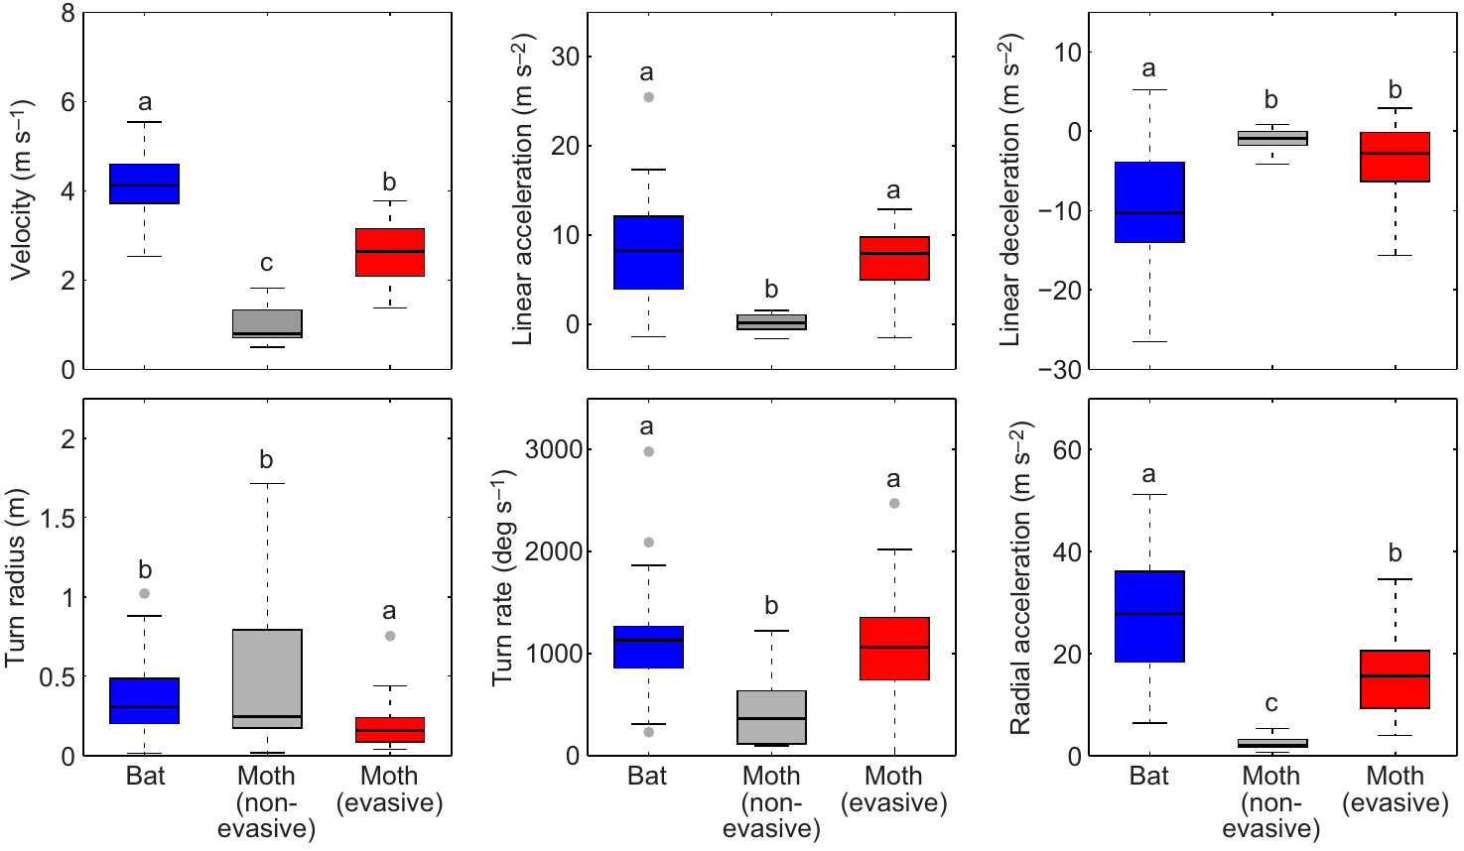
Escape does not require greater speed than the bat
Corcoran and Conner compared maximum flight performance across measured bat-moth encounters. Bats exceeded evasive moths in speed and in several acceleration measures. Peak performance is the strongest movement during an encounter, a movement that happened at the same moment in both animals. The maxima came from each animal's own path.
Bats also had tighter minimum turn radii and greater peak turning performance. Non-evasive prey generally performed worse than evasive prey. Many evasive moths still escaped despite the speed gap, so maximum performance alone did not sort the outcomes. The escape depended on how the maneuver was timed. Acceleration measures were taken from the same flight paths.
A moth can exploit the timing and geometry of a maneuver instead of outrunning the bat along the same path. Maximum values alone say little about who wins a chase. The sequence of moves decides the outcome. The outcome depended on the path the moth took after each turn. Some escapes came from moths slower than the bat.
Corcoran & Conner (2016), Fig. 5. Bat and moth flight performance.
Corcoran & Conner (2016)
37
Notes:
• Corcoran and Conner compared maximum flight performance during measured bat–moth encounters. Bats exceeded evasive moths in speed and several acceleration measures, yet many evasive moths escaped.
• The bats’ advantage also included tighter minimum turn radii and greater peak turning performance. Non-evasive prey generally performed worse than evasive prey, but comparing maximum values alone did not determine the outcome of a chase.
– Peak performance is the strongest measured movement during an encounter, not necessarily the movement occurring simultaneously in predator and prey. A bat capable of a superior maximum can still be unable to follow a specific sudden turn at the required moment.
• A moth can exploit the timing and geometry of a maneuver rather than outrunning the bat along the same path. The comparison concerns the recorded movements within this predator and prey assemblage. It does not establish a universal performance ranking for all bats and moths.
References:
Corcoran AJ, Conner WE (2016). How moths escape bats: predicting outcomes of predator-prey interactions. Journal of Experimental Biology 219: 2704–2715. https://doi.org/10.1242/jeb.137638
Figure: Corcoran & Conner (2016), Fig. 5. Bat and moth flight performance.
Figure source: https://doi.org/10.1242/jeb.137638

Slide 50
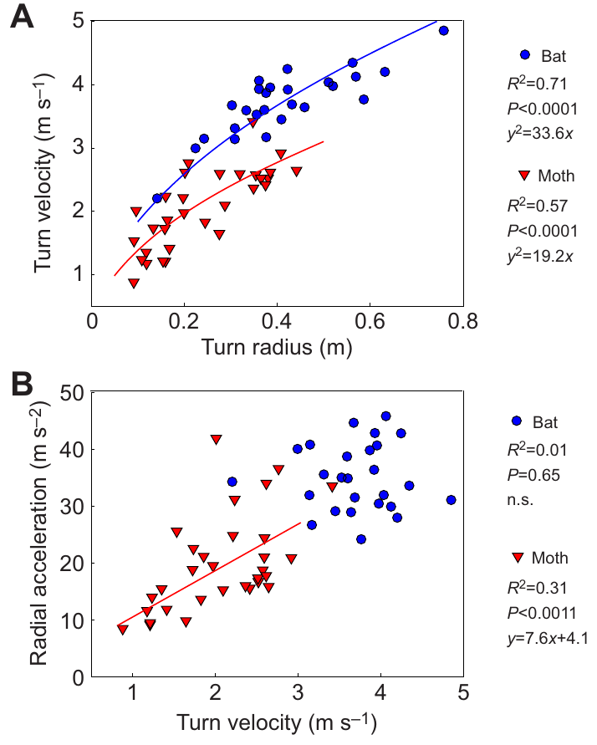
Turning performance combines speed and turn radius
Radial acceleration describes the change in velocity direction during a curved turn. A tighter turn at a given speed needs more radial acceleration. Speed alone leaves out the geometry of the motion, which is why the turn radius matters. Radial acceleration captures the geometry that speed misses. The study compared these measures for moths and bats.
Corcoran and Conner extracted turn speed, radius and radial acceleration from the reconstructed flight paths. Moth radial acceleration rose with turn speed. Bat radial acceleration depended much less on turn speed across the measured range. The two animals differed in how their turns scaled with speed. The measured range set the limits of these comparisons.
These differences set the maneuvers a moth can use during pursuit. A moth can survive without matching the bat's peak acceleration. The outcome depends on whether a turn changes the interception path before the bat follows. The turn changes the path the bat must cover. The bat's peak acceleration was greater than the moth's in these encounters.
Corcoran & Conner (2016), Fig. 6(A–B). Turn speed, radius and radial acceleration.
Corcoran & Conner (2016)
38
Notes:
• **Radial acceleration** describes the change in velocity direction during a curved turn. A tighter turn at a given speed requires greater radial acceleration; speed alone omits the geometry of the motion.
• Corcoran and Conner extracted turn speed, radius and radial acceleration from reconstructed flight paths. Moth radial acceleration increased with turn speed, whereas bat radial acceleration was much less dependent on turn speed in the measured range.
– A minimum turn radius and a maximum speed measured at different moments should not be combined as though they occurred together. The study examined relationships among simultaneously measured turn variables, which preserves the physical relationship within each maneuver.
• These differences constrain the maneuvers available during pursuit. They do not imply that a moth must exceed the bat’s maximum acceleration to survive. The relevant outcome depends on whether a particular turn changes the interception path before the bat can follow it, rather than on one isolated performance value.
References:
Corcoran AJ, Conner WE (2016). How moths escape bats: predicting outcomes of predator-prey interactions. Journal of Experimental Biology 219: 2704–2715. https://doi.org/10.1242/jeb.137638
Figure: Corcoran & Conner (2016), Fig. 6(A–B). Turn speed, radius and radial acceleration.
Figure source: https://doi.org/10.1242/jeb.137638

Slide 51
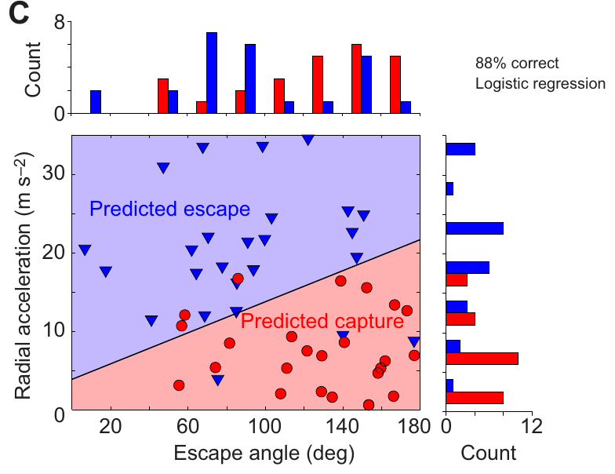
Sharp turns and smaller escape angles favor survival
The escape angle is the direction of the moth's movement relative to the approaching predator. Corcoran and Conner measured it after the initial evasive turn, together with radial acceleration. The angle is a geometric property of the escape. The angle was taken from the three-dimensional paths. Corcoran and Conner measured it in each reconstructed encounter.
Moths escaping at angles of 40 to 100 degrees survived more often than those at angles above 100 degrees. Escaping prey averaged an angle near 83 degrees, whereas captured prey averaged about 126 degrees. Greater radial acceleration also distinguished successful maneuvers from failed ones. Both measures separated escapes from captures.
Turning partly toward or across the approaching bat can work better than flying straight away during a chase. These patterns come from the tested encounters, not from a fixed rule for every moth. The angle describes where the moth ends up relative to the bat. Where the moth ends up decides whether the bat can intercept it.
Corcoran & Conner (2016), Fig. 7(C). Escape outcomes by angle and radial acceleration.
Corcoran & Conner (2016)
39
Notes:
• The **escape angle** is the direction of the moth’s movement relative to the approaching predator. Corcoran and Conner measured it after the initial evasive turn, along with the moth’s radial acceleration.
• Moths escaping with angles of 40–100° survived more often than those taking angles above 100°. Escaping prey averaged an angle near 83°, whereas captured prey averaged near 126°. Greater radial acceleration also distinguished successful maneuvers.
– The escape angle is different from the initial direction of travel before the evasive turn. The source comparison concerns the maneuver’s resulting geometry. High radial acceleration allows rapid redirection, while the angle determines where that redirection places the moth relative to interception.
• Turning partly toward or across the approaching bat can therefore be more effective than continuing directly away during a chase. These are measured associations within the tested encounters, not a command that every moth should follow one fixed angle. The sensory and motor mechanisms choosing the trajectory were not identified.
References:
Corcoran AJ, Conner WE (2016). How moths escape bats: predicting outcomes of predator-prey interactions. Journal of Experimental Biology 219: 2704–2715. https://doi.org/10.1242/jeb.137638
Figure: Corcoran & Conner (2016), Fig. 7(C). Escape outcomes by angle and radial acceleration.
Figure source: https://doi.org/10.1242/jeb.137638

Slide 52
Escape angle and radial acceleration predict outcomes
The escape angle is different from the moth's initial direction of travel before the evasive turn. The angle was measured after the initial turn, not at the start of the chase. A moth's escape angle is measured relative to the bat's approach direction. The angle is measured in three dimensions along the reconstructed path.
High radial acceleration allows rapid redirection, while the angle sets where that redirection places the moth relative to interception. Radial acceleration is a rate of change of direction. Both values came from one set of reconstructed paths. Successful maneuvers were set against failed ones on this measure. Larger angles marked the captured prey.
The sensory and motor mechanisms that choose the trajectory were not identified. The measured flight paths show which geometries worked. Trajectory choice was not measured directly in these encounters. Escape angle and radial acceleration remain the measured variables of this study. The angle and acceleration describe the maneuver, not the sensory input.
Corcoran & Conner (2016), Fig. 7(C). Escape outcomes by angle and radial acceleration.
Corcoran & Conner (2016)
39a
Notes:
• Escape angle and radial acceleration predict outcomes.
• Explanation 1.
– The escape angle is different from the moth's initial direction of travel before the evasive turn
– The angle was measured after the initial turn, not at the start of the chase. A moth's escape angle is measured relative to the bat's approach direction. The angle is measured in three dimensions along the reconstructed path.
• Explanation 2.
– High radial acceleration allows rapid redirection, while the angle sets where that redirection places the moth relative to interception
– Radial acceleration is a rate of change of direction. Both values came from one set of reconstructed paths. Successful maneuvers were set against failed ones on this measure. Larger angles marked the captured prey.
• Explanation 3.
– The sensory and motor mechanisms that choose the trajectory were not identified
– The measured flight paths show which geometries worked. Trajectory choice was not measured directly in these encounters. Escape angle and radial acceleration remain the measured variables of this study. The angle and acceleration describe the maneuver, not the sensory input.
• Source.
– The figure and the measurements come from Corcoran & Conner (2016).
– Each statement above comes from that paper's text, its figure legend or the speaker notes.
References:
Corcoran AJ, Conner WE (2016). How moths escape bats: predicting outcomes of predator-prey interactions. Journal of Experimental Biology 219: 2704–2715. https://doi.org/10.1242/jeb.137638

Slide 53
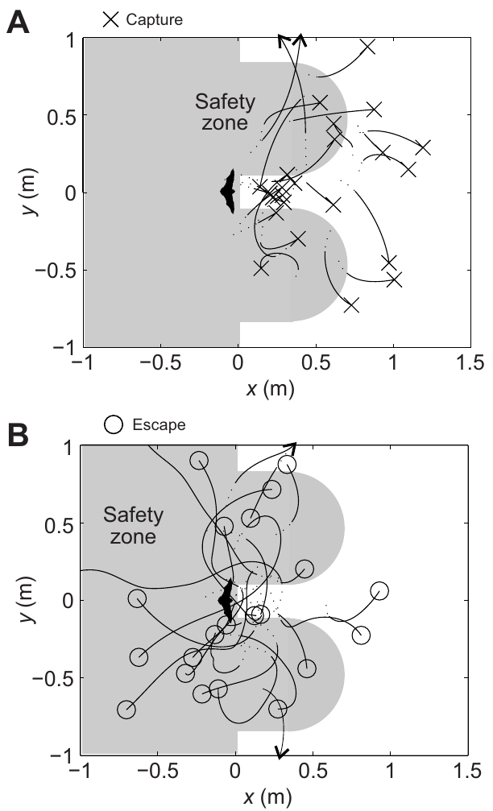
Successful trajectories reach the bat’s flanks
Escaping moths often moved into regions beside the approaching bat rather than backing along its pursuit line. Corcoran and Conner compared reconstructed paths with safety regions predicted by their geometric model. The regions are drawn from modeled pursuit geometry. Each escaping path was checked against the regions. Flank positions were measured in the same reconstructed paths.
The safety zone is a modeled region that the bat would need more time to reach. The model assumes a reaction delay, a capture width and a turning radius. Measured escape paths entered the zone more often than capture paths did, a pattern that matches the model's predictions. The zone gives a geometric account of the escapes.
The flight coordinates come from measurements, while the shaded regions come from the authors' model. Agreement between them gives a geometric account of the maneuvers. The safety regions remain model outputs. The authors' assumptions about reaction delay set the zone's boundaries. Measured paths were set against the modeled regions. The zone sets where a bat would need more time to reach.
Corcoran & Conner (2016), Fig. 3(A–D). Measured three-dimensional evasive flight trajectories.
Corcoran & Conner (2016), Fig. 9(A–B). Measured paths relative to the authors’ modeled safety zones.
Corcoran & Conner (2016)
40
Notes:
• Escaping moths often moved into regions flanking the approaching bat rather than retreating along its existing pursuit axis. Corcoran and Conner compared reconstructed paths with the safety regions predicted by their geometrical model.
• Their **safety zone** is a modeled region the bat cannot immediately intercept under assumptions about reaction delay, capture width and turning radius. Measured escape paths entered it more often than capture paths did.
– Measured flight trajectories are evaluated against regions derived from the authors’ geometrical assumptions. A useful geometrical prediction can explain outcomes even when the animal’s decision mechanism remains unknown.
• The flight coordinates are empirical; the shaded regions and simplified boundaries are the authors’ model-derived interpretation. Agreement supports a geometrical explanation for the observed maneuvers without converting its assumptions into direct measurements. The result does not establish the moth’s internal representation of the zone or a fully identified steering circuit.
References:
Corcoran AJ, Conner WE (2016). How moths escape bats: predicting outcomes of predator-prey interactions. Journal of Experimental Biology 219: 2704–2715. https://doi.org/10.1242/jeb.137638
Figure: Corcoran & Conner (2016), Fig. 9(A–B). Measured paths relative to the authors’ modeled safety zones.
Figure source: https://doi.org/10.1242/jeb.137638
Figure: Corcoran & Conner (2016), Fig. 3(A–D). Measured three-dimensional evasive flight trajectories.
Figure source: https://doi.org/10.1242/jeb.137638

Slide 54
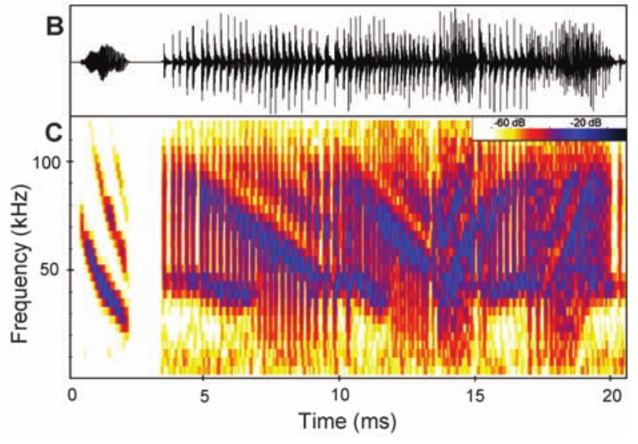
Tiger-moth tymbals produce overlapping ultrasonic clicks
Bertholdia trigona produces dense ultrasonic clicks in response to attacking bats. Its tymbal has a specialized surface for sound production, shown by scanning electron microscopy. The surface is the structure that generates the clicks. Clicking is the defensive output that the tymbal produces. Clicking responded to the presence of an attacking bat.
Corcoran and colleagues compared an example echo from a big brown bat, Eptesicus fuscus, with two overlapping moth click cycles. The published acoustic comparison uses signals estimated to reach a bat 1 m from the moth. The echo in that comparison is a constructed example. The clicks come from the moth's sound production.
The clicks occupy time and frequency ranges that can interfere with returning echoes. Sonar jamming disrupts the bat's use of echoes to locate prey, rather than simply making the moth audible. The jamming effect is the mechanism the authors proposed. Its effectiveness requires behavioral tests of the predator. The jamming hypothesis is tested in the flight room experiments.
Corcoran et al. (2009), Fig. 1(B–C). Published comparison of an example echo and moth clicks.
Corcoran et al. (2009), Fig. 1(A). Sound-producing tymbal; scale bar 1 mm.
Corcoran et al. (2009)
41
Notes:
• _Bertholdia trigona_ produces dense ultrasonic clicking in response to attacking bats. Its tymbal has a specialized surface associated with sound production, documented by scanning electron microscopy.
• Corcoran and colleagues compared an example echo from a big brown bat, _Eptesicus fuscus_, with two overlapping moth click cycles. The published acoustic comparison uses signals at estimated levels reaching a bat 1 m from the moth.
– The echo in the published comparison is a constructed example described by the source authors, whereas the click sequence comes from the moth’s sound production. That acoustic comparison alone does not prove jamming. The tymbal is the sound-output organ and should not be confused with the hearing membrane.
• The clicks occupy time and frequency ranges capable of interfering with returning echoes. **Sonar jamming** means disruption of the bat’s use of echoes for prey localization, rather than simply making the moth audible. Acoustic overlap supports a plausible interference mechanism, but the defense’s effectiveness requires behavioral tests of the predator.
References:
Corcoran AJ, Barber JR, Conner WE (2009). Tiger Moth Jams Bat Sonar. Science 325: 325-327. https://doi.org/10.1126/science.1174096
Figure: Corcoran et al. (2009), Fig. 1(B–C). Published comparison of an example echo and moth clicks.
Figure source: https://doi.org/10.1126/science.1174096
Figure: Corcoran et al. (2009), Fig. 1(A). Sound-producing tymbal; scale bar 1 mm.
Figure source: https://doi.org/10.1126/science.1174096

Slide 55
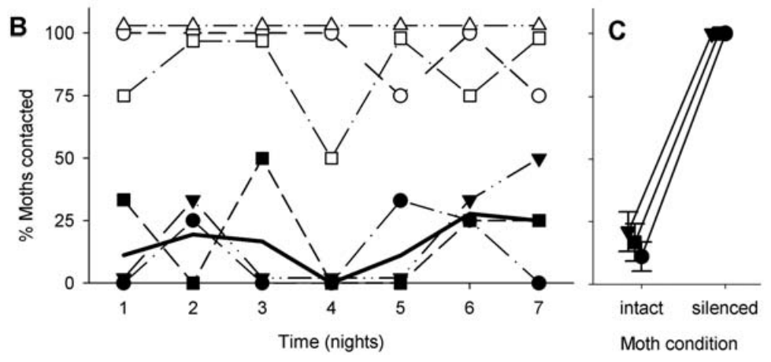
Silencing tymbals removes the protection from clicks
Corcoran and colleagues presented tethered moths to trained big brown bats in a flight room. They recorded attacks with infrared video and ultrasound. Silent palatable moths served as the analysis with clicking Bertholdia trigona in the same room. Both kinds of moth were presented to the same bats. The flight room was set up for trained big brown bats.
Bats contacted the silent controls much more often than clicking moths. After the tymbals were ablated, bats contacted all presented moths in that condition. Ablation means physical removal of the tested structure, here the tymbal. The removal changed the moths' outcome in the flight room. Contact rates for each moth type were recorded during the attacks.
Removing the tymbals changed the outcome, so sound production matters in this setting. Intact clicking moths were contacted far less often than silent controls. The result ties the defense to the sound-producing organ. Ablated moths lost the protection that intact clicking gave them. The silenced condition used the same bats and moth species.
Corcoran et al. (2009), Fig. 2(B–C). Observed contact rates and tymbal-silencing control.
Corcoran et al. (2009), Fig. 1(A). Sound-producing tymbal; scale bar 1 mm.
Corcoran et al. (2009)
42
Notes:
• Corcoran and colleagues presented tethered moths to trained big brown bats in a flight room while recording attacks with infrared video and ultrasound. Silent palatable moths provided a comparison with clicking _Bertholdia trigona_.
• Bats contacted the silent controls much more frequently than clicking moths. After the sound-producing tymbals were ablated, the bats contacted all presented _B. trigona_ in that silenced condition. **Ablation** means physical removal of the tested structure.
– The same moth species was tested with and without the ability to click, helping separate sound production from differences among prey species. Contact was the measured attack-success endpoint. It should not automatically be treated as identical to consumption or long-term survival.
• The intervention links the intact acoustic defense to reduced attack success. It is stronger evidence than observing clicks near a missed capture alone. Tethering restricts evasive flight, and organ removal is a physical manipulation; the experiment establishes the importance of sound production in this preparation rather than every ecological benefit of the species.
References:
Corcoran AJ, Barber JR, Conner WE (2009). Tiger Moth Jams Bat Sonar. Science 325: 325-327. https://doi.org/10.1126/science.1174096
Figure: Corcoran et al. (2009), Fig. 2(B–C). Observed contact rates and tymbal-silencing control.
Figure source: https://doi.org/10.1126/science.1174096
Figure: Corcoran et al. (2009), Fig. 1(A). Sound-producing tymbal; scale bar 1 mm.
Figure source: https://doi.org/10.1126/science.1174096

Slide 56
Tymbal removal raises bat contact rates
The same moth species was tested with and without the ability to click. That design helped separate sound production from differences among prey species. Each moth type was presented to the same bats. Silent palatable moths were the controls in these trials. The moths in the flight room were the same species used throughout.
Contact was the measured endpoint, which is distinct from consumption or long-term survival. Tethering restricts evasive flight, and organ removal is a physical manipulation. Ablation removed the tymbals from the clicking moths. Contact rates were recorded for each moth type. Each contact was recorded during the attack sequence. Tethered moths were the subjects in the same room.
The experiment shows that sound production matters in this preparation, not every ecological benefit of the species. The bats' contact rates changed with the tymbal, the one variable tested. Tymbal removal altered the contact outcome for the same bats. The intervention is stronger evidence than observing clicks near a missed capture alone.
Corcoran et al. (2009), Fig. 2(B–C). Observed contact rates and tymbal-silencing control.
Corcoran et al. (2009), Fig. 1(A). Sound-producing tymbal; scale bar 1 mm.
Corcoran et al. (2009)
42a
Notes:
• Tymbal removal raises bat contact rates.
• Explanation 1.
– The same moth species was tested with and without the ability to click
– That design helped separate sound production from differences among prey species. Each moth type was presented to the same bats. Silent palatable moths were the controls in these trials. The moths in the flight room were the same species used throughout.
• Explanation 2.
– Contact was the measured endpoint, which is distinct from consumption or long-term survival
– Tethering restricts evasive flight, and organ removal is a physical manipulation. Ablation removed the tymbals from the clicking moths. Contact rates were recorded for each moth type. Each contact was recorded during the attack sequence. Tethered moths were the subjects in the same room.
• Explanation 3.
– The experiment shows that sound production matters in this preparation, not every ecological benefit of the species
– The bats' contact rates changed with the tymbal, the one variable tested. Tymbal removal altered the contact outcome for the same bats. The intervention is stronger evidence than observing clicks near a missed capture alone.
• Source.
– The figure and the measurements come from Corcoran et al. (2009).
– Each statement above comes from that paper's text, its figure legend or the speaker notes.
References:
Corcoran AJ, Barber JR, Conner WE (2009). Tiger Moth Jams Bat Sonar. Science 325: 325-327. https://doi.org/10.1126/science.1174096

Slide 57
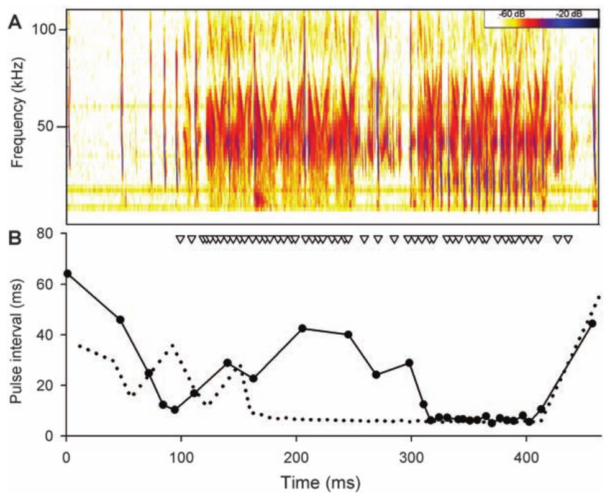
Persistent protection supports jamming over startle
A startle defense should weaken as a predator becomes used to the sound. A learned warning should change as the predator learns that the signal predicts an unpleasant prey item. The two ideas predict different attack patterns over repeated experience. Each idea implies a different course of attacks across nights.
In Corcoran and colleagues' experiment, protection from clicks appeared at once and persisted over successive nights. Bats that ate the moths still struggled to contact clicking individuals. Attacks often continued after the sound began. The persistence was measured across several nights. The bats that ate the moths were the group with the clearest effect.
Individual bats differed in how they responded to palatability, so the strongest interpretation applies to bats that ate the moths. Juvenile bats without clicking-prey experience and an experienced adult were both tested. Palatability was examined for each bat separately. Their responses were set against those of the experienced adult. Juvenile bats had no earlier exposure to clicking prey.
Corcoran et al. (2009), Fig. 2(B–C). Observed contact rates and tymbal-silencing control.
Corcoran et al. (2009), Fig. 3(A–B). Echolocation timing during an attack on a clicking moth.
Corcoran et al. (2009)
43
Notes:
• A startle defense should weaken as a predator becomes accustomed to the sound, whereas a learned warning should change as the predator associates the signal with an unpleasant prey item. These alternatives predict different attack patterns over repeated experience.
• In Corcoran and colleagues’ experiment, protection from _Bertholdia trigona_ clicks appeared immediately and persisted over successive nights. Bats that ate the moths still had difficulty contacting clicking individuals, and attacks often continued after the sound began.
– The investigators included juvenile bats without prior experience of clicking prey and an experienced adult. The persistence comparison is behavioral evidence, while palatability observations address the warning alternative. More than one defensive function can coexist, so the conclusion is not that moth clicks can never warn or startle.
• The pattern supports sonar interference over a purely transient startle effect or learned rejection of distasteful prey. Individual bats differed in palatability responses, so the strongest interpretation concerns those that consumed the moths. The experiment supports jamming without identifying one exclusive neural mechanism of echo disruption.
References:
Corcoran AJ, Barber JR, Conner WE (2009). Tiger Moth Jams Bat Sonar. Science 325: 325-327. https://doi.org/10.1126/science.1174096
Figure: Corcoran et al. (2009), Fig. 2(B–C). Observed contact rates and tymbal-silencing control.
Figure source: https://doi.org/10.1126/science.1174096
Figure: Corcoran et al. (2009), Fig. 3(A–B). Echolocation timing during an attack on a clicking moth.
Figure source: https://doi.org/10.1126/science.1174096

Slide 58
Moth clicks disrupt the progression of an attack
Big brown bats attacking silent control moths normally moved through approach, tracking and terminal echolocation stages. Corcoran and colleagues recorded a different timing pattern during some attacks on clicking Bertholdia trigona. The difference appeared during some attacks on clicking moths. The stages were identified from the call timing. These stages were defined by the bat's echolocation timing.
After moth clicks began, bats sometimes lengthened their pulse intervals and returned to an earlier attack stage before resuming pursuit. These reversals occurred in roughly one third of clicking-moth attacks and persisted with experience. The reversals continued as the bats gained experience with clicking prey. The reversals were recorded over repeated sessions.
Clicks disrupted the hunting sequence rather than ending it at the first click. Call timing marks the change in pursuit, but the bats' perceived distance to the moth was never measured. Clicks changed the sequence of calls that followed. The authors compared attack progression across silent and clicking moths. Attacks on silent moths showed the normal stage order.
Corcoran et al. (2009), Fig. 3(A–B). Echolocation timing during an attack on a clicking moth.
Corcoran et al. (2009)
44
Notes:
• Big brown bats attacking silent control moths normally progressed through approach, tracking and terminal echolocation stages. Corcoran and colleagues recorded a different temporal pattern during some attacks on clicking _Bertholdia trigona_.
• After moth clicks began, bats sometimes lengthened their pulse intervals and returned to an earlier attack stage before continuing pursuit. Such reversals occurred in roughly one third of the clicking-moth attacks and persisted with experience.
– The spectrogram records frequency against time, and the interval plot records the spacing between emitted bat calls. Moth click timing is retained separately. A change in call progression is an observed predator response, while the precise sensory confusion inside the bat remains inferred.
• The acoustic record links interference with disrupted hunting progression rather than simple abandonment whenever a click is heard. It complements the tymbal-silencing and repeated-exposure controls. The study does not directly measure the bat’s perceived target distance or establish whether false echoes, masking or disrupted range processing contributes most to the failure.
References:
Corcoran AJ, Barber JR, Conner WE (2009). Tiger Moth Jams Bat Sonar. Science 325: 325-327. https://doi.org/10.1126/science.1174096
Figure: Corcoran et al. (2009), Fig. 3(A–B). Echolocation timing during an attack on a clicking moth.
Figure source: https://doi.org/10.1126/science.1174096

Slide 59
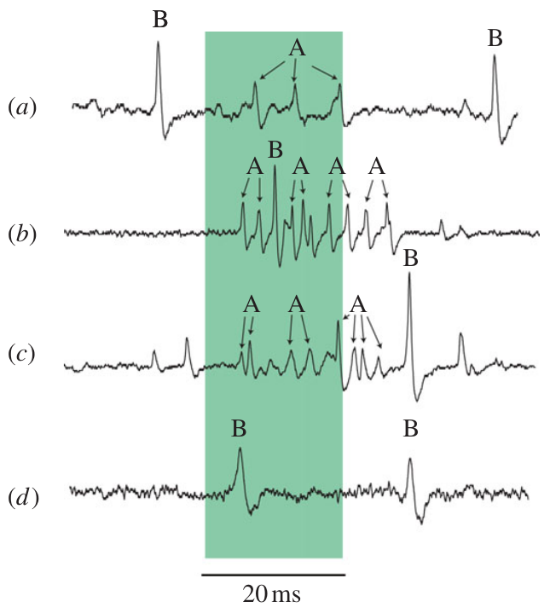
Hearing measurements constrain claims about escape
Sound reception, neural coding and defensive behavior are separate experimental outcomes. Wax-moth recordings showed spikes to 300 kHz sound, and no flight test covered that frequency. Each outcome needs its own measurement. A nerve response alone says little about flight. The wax-moth recordings and the noctuid plateau come from different preparations.
In noctuid moths, a short-pulse A1 plateau codes intensity coarsely through spike count, despite a clear auditory response. A receptor can register the presence of sound without reporting every change in its amplitude. The wax-moth traces separate spikes that follow sound from spontaneous spikes. The short-pulse plateau is one example of that gap.
Turning those signals into behavior needs central recordings, interventions and measured escape or clicking responses. Roeder's pulse-marker observations and the later flight and tymbal experiments each address a different step in that chain. Together they trace the path from ear to defense one step at a time. Measured escape and clicking responses are the endpoints of that chain.
Gordon & ter Hofstede (2018), Fig. 3(A). A1 saturation before A2 recruitment in Raphia frater.
Moir et al. (2013), Fig. 2(a–d). Auditory spikes at 80, 280 and 300 kHz.
Moir et al. (2013); Gordon & ter Hofstede (2018); Roeder (1966); Corcoran & Conner (2016); Corcoran et al. (2009)
45
Notes:
• Sound reception, neural coding and defensive behavior are distinct experimental outcomes. Wax-moth recordings established spikes to 300-kHz stimulation, but did not establish evasive flight at that frequency.
• In noctuid moths, a short-pulse A1 plateau established limited intensity coding through spike count despite a clear auditory response. A receptor can therefore register the presence of sound without continuously reporting every change in its amplitude.
– The wax-moth traces distinguish sound-associated A spikes from non-acoustic B spikes, including an example without an auditory response at the tested high frequency. The noctuid plateau is a separate limitation in a different preparation. Neither result should be generalized as a complete account of all moth hearing.
• Connecting those signals to behavior requires central recordings and interventions, as well as measurements of the actual escape or clicking response. Roeder’s pulse-marker observations and the later flight and tymbal experiments address different links in that chain. The measured findings support a sensory defense while leaving the full molecular and sensorimotor mechanism incompletely resolved.
References:
Moir HM, Jackson JC, Windmill JFC (2013). Extremely high frequency sensitivity in a ‘simple’ ear. Biology Letters 9: 20130241. https://doi.org/10.1098/rsbl.2013.0241
Gordon SD, ter Hofstede HM (2018). The influence of bat echolocation call duration and timing on auditory encoding of predator distance in noctuoid moths. Journal of Experimental Biology 221: jeb171561. https://doi.org/10.1242/jeb.171561
Roeder KD (1966). Interneurons of the thoracic nerve cord activated by tympanic nerve fibres in noctuid moths. Journal of Insect Physiology 12: 1227-1244. https://doi.org/10.1016/0022-1910(66)90014-x
Corcoran AJ, Conner WE (2016). How moths escape bats: predicting outcomes of predator-prey interactions. Journal of Experimental Biology 219: 2704–2715. https://doi.org/10.1242/jeb.137638
Corcoran AJ, Barber JR, Conner WE (2009). Tiger Moth Jams Bat Sonar. Science 325: 325-327. https://doi.org/10.1126/science.1174096
Figure: Moir et al. (2013), Fig. 2(a–d). Auditory spikes at 80, 280 and 300 kHz.
Figure source: https://doi.org/10.1098/rsbl.2013.0241
Figure: Gordon & ter Hofstede (2018), Fig. 3(A). A1 saturation before A2 recruitment in Raphia frater.
Figure source: https://doi.org/10.1242/jeb.171561

Slide 60
Key takeaways
Mechanical coupling: Tympanic displacement drives receptor excitation; in the measured noctuid preparation, A1 and A2 differ substantially in displacement threshold.
Range and timing: A1 is more sensitive than A2, but short calls can saturate A1 before A2 recruitment. Pulse duration and repetition influence the information reaching central neurons.
Central transformation: Repeaters preserve much of an afferent burst, whereas pulse-marker units select event timing. Their transmitters and complete causal escape circuit were not established by the extracellular recordings.
Escape geometry: Moths can survive faster bats through sharply timed turns and trajectories toward the predator’s flanks. Radial acceleration and escape angle predict outcomes better than speed alone.
Acoustic defense: Tiger-moth clicks can jam bat sonar. Sound-organ silencing and persistent protection across repeated attacks provide causal and comparative evidence for this defense.
Evidence limits: Hearing a sound, encoding its intensity and executing escape are different outcomes. A neural threshold or a model prediction alone does not prove the corresponding defensive behavior.
ter Hofstede et al. (2011); Gordon & ter Hofstede (2018); Roeder (1966); Corcoran & Conner (2016); Corcoran et al. (2009)
46
Notes:
References:
ter Hofstede HM, Goerlitz HR, Montealegre-Z F, Robert D, Holderied MW (2011). Tympanal mechanics and neural responses in the ears of a noctuid moth. Naturwissenschaften 98: 1057-1061. https://doi.org/10.1007/s00114-011-0851-7
Gordon SD, ter Hofstede HM (2018). The influence of bat echolocation call duration and timing on auditory encoding of predator distance in noctuoid moths. Journal of Experimental Biology 221: jeb171561. https://doi.org/10.1242/jeb.171561
Roeder KD (1966). Interneurons of the thoracic nerve cord activated by tympanic nerve fibres in noctuid moths. Journal of Insect Physiology 12: 1227-1244. https://doi.org/10.1016/0022-1910(66)90014-x
Corcoran AJ, Conner WE (2016). How moths escape bats: predicting outcomes of predator-prey interactions. Journal of Experimental Biology 219: 2704–2715. https://doi.org/10.1242/jeb.137638
Corcoran AJ, Barber JR, Conner WE (2009). Tiger Moth Jams Bat Sonar. Science 325: 325-327. https://doi.org/10.1126/science.1174096

