Slide 1
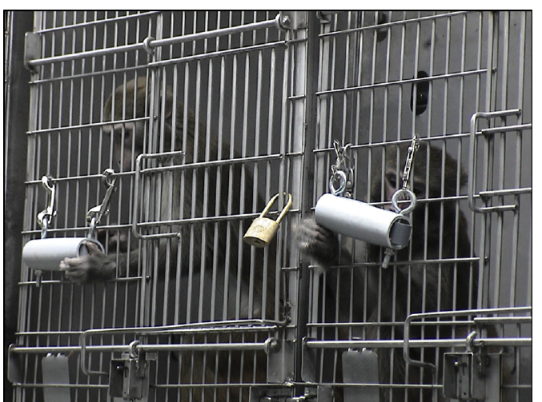
NEUR 411 · NEUROETHOLOGY · FALL 2026
Lecture 53
Comparative Neuroethics:
The Neurobiology of Captivity, Stress, and Behavioral Pathology Across Taxa
Date TBD
Gottlieb et al. (2015), Fig. 1. Rhesus macaques using a foraging device.
Jordan Lopez, Ph.D.
Professor of Neurobiology & Biomedical Engineering
Notes:
Comparative Neuroethics: The Neurobiology of Captivity, Stress, and Behavioral Pathology Across Taxa
Lecture 53. NEUR 411 · NEUROETHOLOGY · FALL 2026. Date TBD.
Figure: Gottlieb et al. (2015), Fig. 1. Rhesus macaques using a foraging device.
Figure source: https://doi.org/10.1016/j.applanim.2015.08.005
References:
Gottlieb DH, Maier A, Coleman K (2015). Evaluation of environmental and intrinsic factors that contribute to stereotypic behavior in captive rhesus macaques (Macaca mulatta). Applied Animal Behaviour Science 171: 184-191. https://doi.org/10.1016/j.applanim.2015.08.005

Slide 2
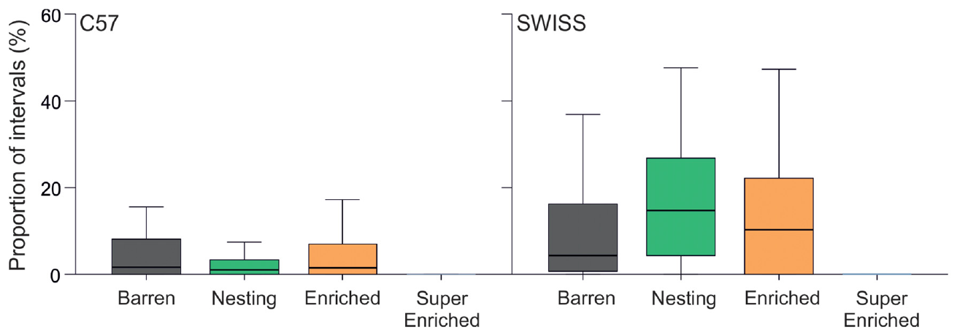
Complex housing reduces repetitive behavior
Stereotypy is repetitive behavior with little variation and no obvious immediate goal. Bailoo and colleagues recorded female C57 and SWISS mice in barren, nesting-only, enriched, or super-enriched housing. Video scoring expressed stereotypy as a proportion of active time, separating repetition from simple inactivity.
The super-enriched condition connected two cages and provided shelters, climbing opportunities, tunnels, and regularly changed objects. Stereotypy was greatly reduced in both strains compared with the other conditions; nesting material or modest enrichment did not produce a consistent equivalent reduction.
Bar mouthing, circling, twirling and back-flipping were scored separately. Their expression differed between strains, while the largest reduction in total stereotypy occurred with the most extensive resources. Enclosure structure changed which actions mice could perform and how their active time was distributed among those actions.
Bailoo et al. (2018), Fig. 3. Stereotypy under four housing conditions.
Bailoo et al. (2018)
02
Notes:
• Stereotypy is repetitive behavior with little variation and no obvious immediate goal. Bailoo and colleagues recorded female C57 and SWISS mice in barren, nesting-only, enriched, or super-enriched housing. Video scoring expressed stereotypy as a proportion of active time, separating repetition from simple inactivity.
• The super-enriched condition connected two cages and provided shelters, climbing opportunities, tunnels, and regularly changed objects. Stereotypy was greatly reduced in both strains compared with the other conditions; nesting material or modest enrichment did not produce a consistent equivalent reduction.
• Bar mouthing, circling, twirling and back-flipping were scored separately. Their expression differed between strains, while the largest reduction in total stereotypy occurred with the most extensive resources. Enclosure structure changed which actions mice could perform and how their active time was distributed among those actions.
• Bar mouthing, circling, twirling, and back-flipping were scored as distinct patterns. Their responses varied between strains, so a total stereotypy score summarizes behaviors that may have different origins. These experimentally allocated housing conditions provide stronger evidence about housing effects than a comparison of unrelated facilities.
References:
Bailoo JD, Murphy E, Boada-Saña M, Varholick JA, Hintze S, Baussière C, Hahn KC, Göpfert C, Palme R, Voelkl B, Würbel H (2018). Effects of Cage Enrichment on Behavior, Welfare and Outcome Variability in Female Mice. Frontiers in Behavioral Neuroscience 12: 232. https://doi.org/10.3389/fnbeh.2018.00232
Figure: Bailoo et al. (2018), Fig. 3. Stereotypy under four housing conditions.
Figure source: https://doi.org/10.3389/fnbeh.2018.00232

Slide 3
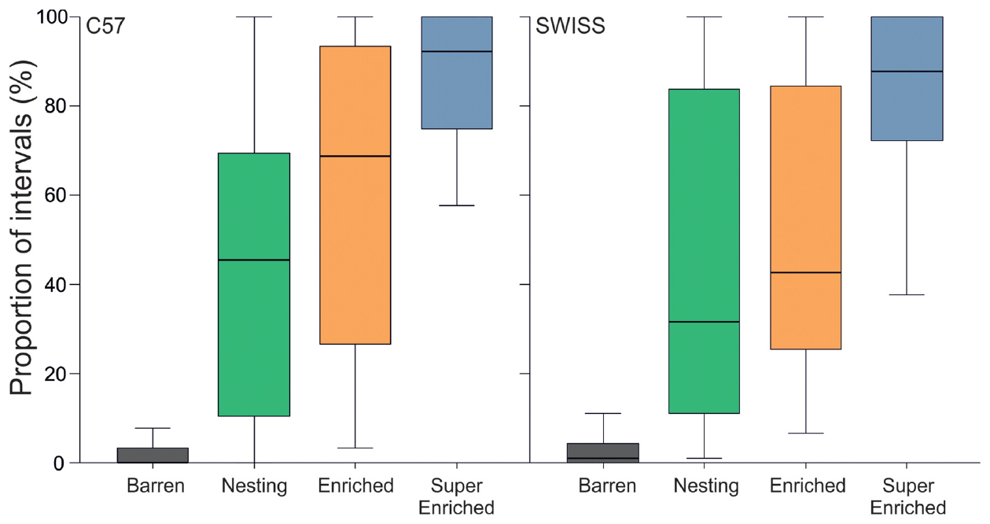
Mice actively use opportunities in complex cages
Environmental enrichment supplies resources that allow more species-typical activity than basic food, water, and bedding alone. In the same experiment, mice were scored as engaged when they contacted an enrichment item or manipulated the housing environment, including bedding in barren cages.
Mice in the super-enriched condition engaged with their environment during more than 85% of observed intervals on average. Barren-housed mice engaged least, while nesting and enriched cages supported intermediate levels. The comparison therefore measures use of resources rather than their mere presence.
The engagement category included being inside, on or under a shelter as well as manipulating objects. Complex housing supplied protected resting locations and opportunities to climb and explore. These resources supported different activities within the same cage, explaining why engagement encompassed more than locomotion alone.
Bailoo et al. (2018), Fig. 2. Engagement with enriched housing.
Bailoo et al. (2018)
03
Notes:
• Environmental enrichment supplies resources that allow more species-typical activity than basic food, water, and bedding alone. In the same experiment, mice were scored as engaged when they contacted an enrichment item or manipulated the housing environment, including bedding in barren cages.
• Mice in the super-enriched condition engaged with their environment during more than 85% of observed intervals on average. Barren-housed mice engaged least, while nesting and enriched cages supported intermediate levels. The comparison therefore measures use of resources rather than their mere presence.
• The engagement category included being inside, on or under a shelter as well as manipulating objects. Complex housing supplied protected resting locations and opportunities to climb and explore. These resources supported different activities within the same cage, explaining why engagement encompassed more than locomotion alone.
• The ethogram counted being inside, on, or under an enrichment object as contact. A protected sleeping location and an object used for exploration can both be valuable resources, but the scoring method does not identify which motivation produced each observation. The mice were socially housed across treatments.
References:
Bailoo JD, Murphy E, Boada-Saña M, Varholick JA, Hintze S, Baussière C, Hahn KC, Göpfert C, Palme R, Voelkl B, Würbel H (2018). Effects of Cage Enrichment on Behavior, Welfare and Outcome Variability in Female Mice. Frontiers in Behavioral Neuroscience 12: 232. https://doi.org/10.3389/fnbeh.2018.00232
Figure: Bailoo et al. (2018), Fig. 2. Engagement with enriched housing.
Figure source: https://doi.org/10.3389/fnbeh.2018.00232

Slide 4
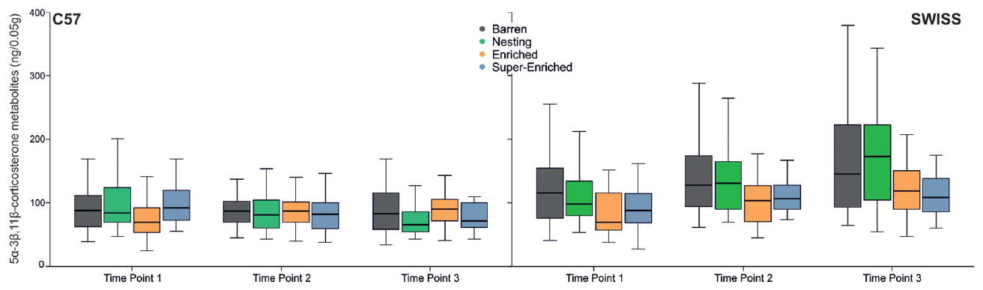
Hormone responses depend on mouse strain
Glucocorticoids are adrenal hormones involved in the physiological response to stress; corticosterone is a major rodent glucocorticoid. Bailoo and colleagues measured its fecal metabolites, products formed after hormone processing, to compare endocrine outcomes without taking blood during the measurement.
SWISS mice in barren and nesting-only cages had higher metabolite concentrations than mice in enriched and super-enriched cages. C57 mice did not exhibit the same consistent housing effect. Concentrations were reported in ng per 0.05 g of feces, and excretion reflects secretion delayed by approximately 8–10 hours.
Cage changing reorganizes the animals’ immediate surroundings, and hormone secretion reaches the feces after a physiological delay. Collection timing therefore connects the endocrine measurement to this husbandry event. The strain comparison separates a shared reduction in stereotypy from a hormone response that depended on genetic background.
Bailoo et al. (2018), Fig. 10. Fecal glucocorticoid metabolites by strain and housing.
Bailoo et al. (2018)
04
Notes:
• Glucocorticoids are adrenal hormones involved in the physiological response to stress; corticosterone is a major rodent glucocorticoid. Bailoo and colleagues measured its fecal metabolites, products formed after hormone processing, to compare endocrine outcomes without taking blood during the measurement.
• SWISS mice in barren and nesting-only cages had higher metabolite concentrations than mice in enriched and super-enriched cages. C57 mice did not exhibit the same consistent housing effect. Concentrations were reported in ng per 0.05 g of feces, and excretion reflects secretion delayed by approximately 8–10 hours.
• Cage changing reorganizes the animals’ immediate surroundings, and hormone secretion reaches the feces after a physiological delay. Collection timing therefore connects the endocrine measurement to this husbandry event. The strain comparison separates a shared reduction in stereotypy from a hormone response that depended on genetic background.
• Fecal measurements integrate secretion over a delay rather than capturing the circulating concentration at the exact moment of collection. The strain difference persisted despite common housing categories and measurement procedures. Consequently, an endocrine criterion applied identically to every strain could miss a meaningful behavioral improvement.
References:
Bailoo JD, Murphy E, Boada-Saña M, Varholick JA, Hintze S, Baussière C, Hahn KC, Göpfert C, Palme R, Voelkl B, Würbel H (2018). Effects of Cage Enrichment on Behavior, Welfare and Outcome Variability in Female Mice. Frontiers in Behavioral Neuroscience 12: 232. https://doi.org/10.3389/fnbeh.2018.00232
Figure: Bailoo et al. (2018), Fig. 10. Fecal glucocorticoid metabolites by strain and housing.
Figure source: https://doi.org/10.3389/fnbeh.2018.00232

Slide 5
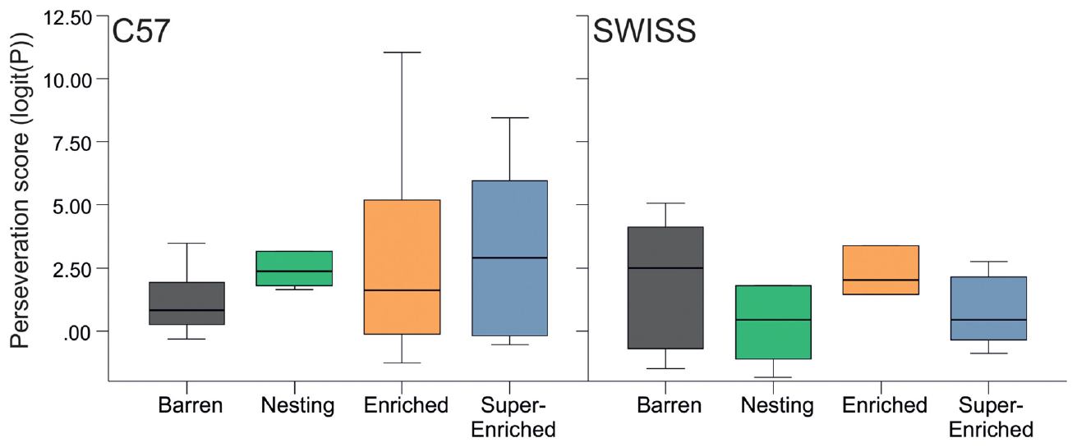
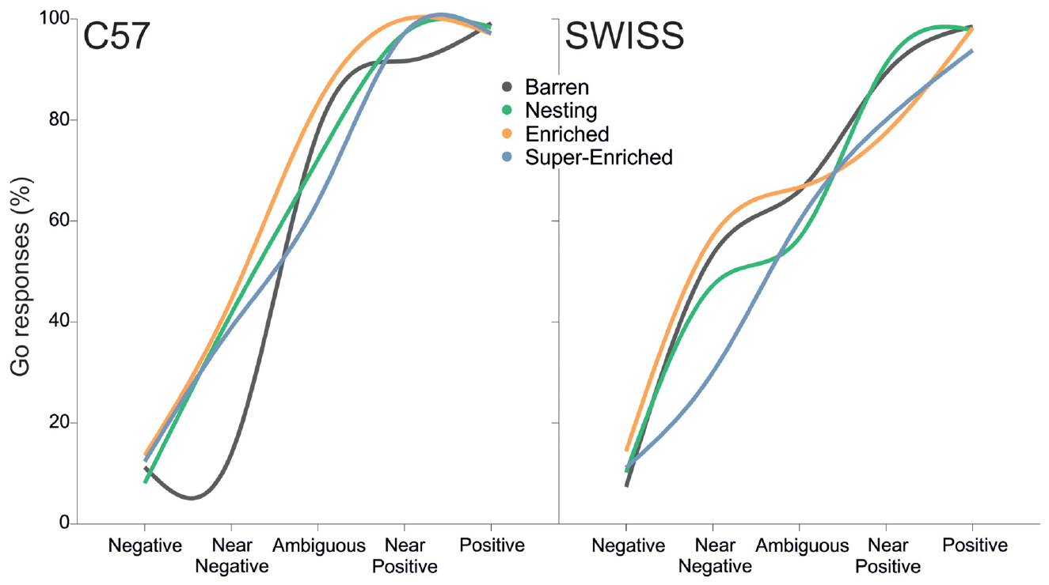
Different welfare measures can disagree
Perseveration is inappropriate persistence in a response pattern when changing responses would be useful. Mice completed a two-choice guessing task in which reward probabilities depended on their preceding choices. This assessed inhibitory control separately from home-cage stereotypy.
Housing condition and stereotypy level did not consistently predict the perseveration score. A separate spatial judgment task trained mice to approach a rewarded location and withhold approach at a nonrewarded location, then tested three intermediate locations. Enrichment did not cause a consistent shift toward approaching ambiguous cues across both strains.
A judgment task measures responses to cues between previously rewarded and unrewarded locations. Inhibitory control in the guessing task and approach to ambiguous locations tested different processes from repetitive movement. Housing altered home-cage behavior while these decision measures remained comparatively unchanged, separating behavioral flexibility from the amount of visible repetition.
Bailoo et al. (2018), Fig. 12. Perseveration in a guessing task.
Bailoo et al. (2018), Fig. 14. Responses to spatially ambiguous cues.
Bailoo et al. (2018)
05
Notes:
• Perseveration is inappropriate persistence in a response pattern when changing responses would be useful. Mice completed a two-choice guessing task in which reward probabilities depended on their preceding choices. This assessed inhibitory control separately from home-cage stereotypy.
• Housing condition and stereotypy level did not consistently predict the perseveration score. A separate spatial judgment task trained mice to approach a rewarded location and withhold approach at a nonrewarded location, then tested three intermediate locations. Enrichment did not cause a consistent shift toward approaching ambiguous cues across both strains.
• A judgment task measures responses to cues between previously rewarded and unrewarded locations. Inhibitory control in the guessing task and approach to ambiguous locations tested different processes from repetitive movement. Housing altered home-cage behavior while these decision measures remained comparatively unchanged, separating behavioral flexibility from the amount of visible repetition.
• The judgment task measures decisions under uncertainty; it does not ask the mouse to report a feeling. Its near-negative trials were particularly variable. The appropriate conclusion is that these tasks did not yield a consistent enrichment effect, rather than that the mice lacked emotional states or that the housing changes were ineffective.
References:
Bailoo JD, Murphy E, Boada-Saña M, Varholick JA, Hintze S, Baussière C, Hahn KC, Göpfert C, Palme R, Voelkl B, Würbel H (2018). Effects of Cage Enrichment on Behavior, Welfare and Outcome Variability in Female Mice. Frontiers in Behavioral Neuroscience 12: 232. https://doi.org/10.3389/fnbeh.2018.00232
Figure: Bailoo et al. (2018), Fig. 12. Perseveration in a guessing task.
Figure source: https://doi.org/10.3389/fnbeh.2018.00232
Figure: Bailoo et al. (2018), Fig. 14. Responses to spatially ambiguous cues.
Figure source: https://doi.org/10.3389/fnbeh.2018.00232

Slide 6
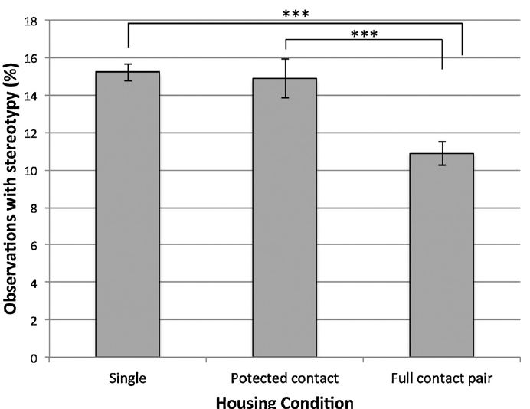
Full social contact predicts less macaque stereotypy
Full-contact pair housing was associated with less stereotypy than either solitary housing or protected contact. The protected-contact partition had bars 4.5 cm apart but did not provide the same association with reduced stereotypy. Foraging devices were also associated with a lower likelihood of stereotypy when present.
Gottlieb and colleagues assessed captive rhesus macaques using 5-minute behavioral observations over 11 years. Motor stereotypies were repeated whole-body movements such as pacing, rocking, and somersaulting. Housing categories distinguished solitary cages, protected contact through bars, and full access to a social partner.
All housing categories allowed visual access to another macaque. Full-contact pairing additionally permitted direct interaction, whereas the partition restricted the range of available social actions. Foraging devices supplied another opportunity to obtain resources through activity. Social access and food-directed activity each accompanied lower stereotypy in the observed population.
Gottlieb et al. (2015), Fig. 2. Motor stereotypy across social housing conditions.
Gottlieb et al. (2015), Fig. 1. Rhesus macaques using a foraging device.
Gottlieb et al. (2015)
06
Notes:
• Full-contact pair housing was associated with less stereotypy than either solitary housing or protected contact. The protected-contact partition had bars 4.5 cm apart but did not provide the same association with reduced stereotypy. Foraging devices were also associated with a lower likelihood of stereotypy when present.
• Gottlieb and colleagues assessed captive rhesus macaques using 5-minute behavioral observations over 11 years. Motor stereotypies were repeated whole-body movements such as pacing, rocking, and somersaulting. Housing categories distinguished solitary cages, protected contact through bars, and full access to a social partner.
• All housing categories allowed visual access to another macaque. Full-contact pairing additionally permitted direct interaction, whereas the partition restricted the range of available social actions. Foraging devices supplied another opportunity to obtain resources through activity. Social access and food-directed activity each accompanied lower stereotypy in the observed population.
• All monkeys had visual access to another monkey, including those classed as singly housed. The comparison concerns the degree of interaction, not complete sensory isolation. Compatible full-contact pairing permits a wider range of social actions, but the study did not establish which particular action accounted for the association.
References:
Gottlieb DH, Maier A, Coleman K (2015). Evaluation of environmental and intrinsic factors that contribute to stereotypic behavior in captive rhesus macaques (Macaca mulatta). Applied Animal Behaviour Science 171: 184-191. https://doi.org/10.1016/j.applanim.2015.08.005
Figure: Gottlieb et al. (2015), Fig. 2. Motor stereotypy across social housing conditions.
Figure source: https://doi.org/10.1016/j.applanim.2015.08.005
Figure: Gottlieb et al. (2015), Fig. 1. Rhesus macaques using a foraging device.
Figure source: https://doi.org/10.1016/j.applanim.2015.08.005

Slide 7
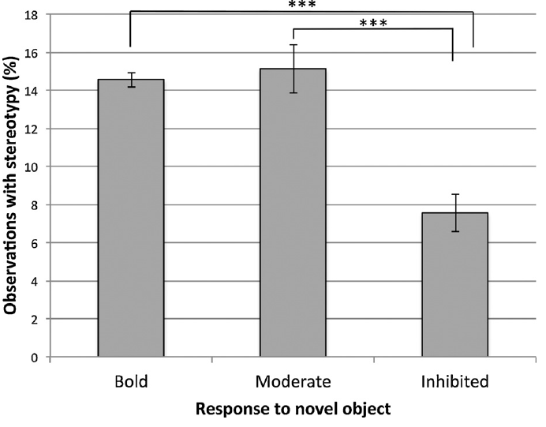
Temperament predicts stereotypy expression
Behavioral inhibition describes withdrawal from unfamiliar situations. After observing stereotypy, investigators presented a novel food item and recorded inspection for 3 minutes. Macaques inspecting within 5 seconds were classified as bold; later inspection was moderate, and no inspection was inhibited.
Bold and moderate responders were more likely to express motor stereotypy than inhibited responders. The association remained in a model that also included housing, enrichment, rearing history, ancestry, and age. A visibly active monkey and a withdrawn monkey can therefore express an adverse environment differently.
Inspection included deliberate visual, olfactory or tactile examination of the novel food. Eating was not required. The classification therefore concerned willingness to investigate an unfamiliar item, distinguishing novelty-directed activity from consumption. That response profile accompanied differences in how repetitive movement was expressed in the home cage.
Gottlieb et al. (2015), Fig. 3. Motor stereotypy and novel-object responses.
Gottlieb et al. (2015), Fig. 1. Rhesus macaques using a foraging device.
Gottlieb et al. (2015)
07
Notes:
• Behavioral inhibition describes withdrawal from unfamiliar situations. After observing stereotypy, investigators presented a novel food item and recorded inspection for 3 minutes. Macaques inspecting within 5 seconds were classified as bold; later inspection was moderate, and no inspection was inhibited.
• Bold and moderate responders were more likely to express motor stereotypy than inhibited responders. The association remained in a model that also included housing, enrichment, rearing history, ancestry, and age. A visibly active monkey and a withdrawn monkey can therefore express an adverse environment differently.
• Inspection included deliberate visual, olfactory or tactile examination of the novel food. Eating was not required. The classification therefore concerned willingness to investigate an unfamiliar item, distinguishing novelty-directed activity from consumption. That response profile accompanied differences in how repetitive movement was expressed in the home cage.
• Inspection included deliberate visual, olfactory, or tactile examination of the item. A monkey did not have to eat it to count as inspecting. This distinction separates willingness to investigate novelty from food consumption and prevents interpreting every failure to eat as a failure to approach.
References:
Gottlieb DH, Maier A, Coleman K (2015). Evaluation of environmental and intrinsic factors that contribute to stereotypic behavior in captive rhesus macaques (Macaca mulatta). Applied Animal Behaviour Science 171: 184-191. https://doi.org/10.1016/j.applanim.2015.08.005
Figure: Gottlieb et al. (2015), Fig. 3. Motor stereotypy and novel-object responses.
Figure source: https://doi.org/10.1016/j.applanim.2015.08.005
Figure: Gottlieb et al. (2015), Fig. 1. Rhesus macaques using a foraging device.
Figure source: https://doi.org/10.1016/j.applanim.2015.08.005

Slide 8
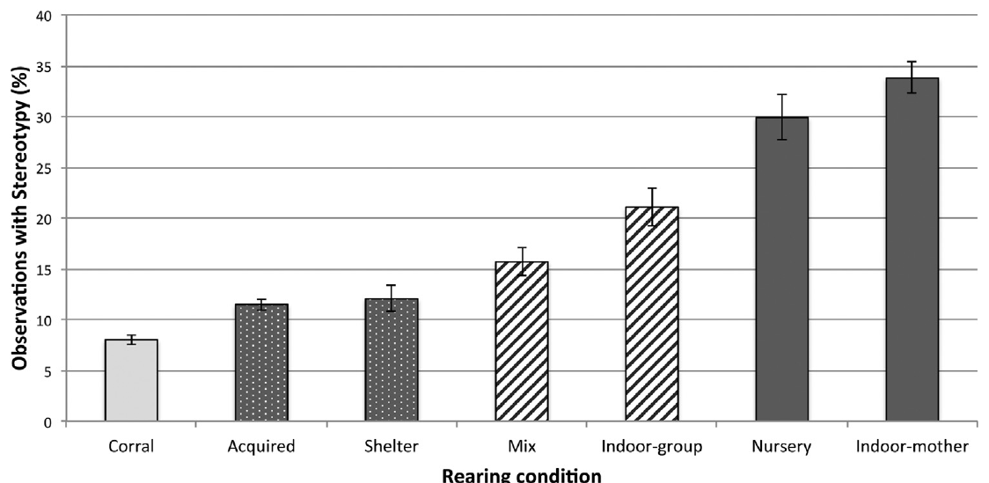
Early rearing predicts later repetitive behavior
Nursery-reared and indoor mother-reared monkeys had the highest modeled risk of motor stereotypy, whereas corral-reared animals had the lowest. Current housing and foraging conditions were included alongside early history, so the analysis did not attribute every adult difference to the cage occupied at observation.
The macaque analysis also classified the environment experienced during the first 6 months of life. Outdoor corral rearing provided a large social group, while other categories included sheltered groups, indoor groups, nursery rearing, and indoor mother rearing. These histories differed before the adult observations began.
Early rearing supplied different combinations of space, social partners and contact with mothers or caregivers. Those experiences preceded the adult housing observations by years. Adult stereotypy consequently reflected a developmental history as well as current social and foraging opportunities, linking present behavior to resources experienced at different life stages.
Gottlieb et al. (2015), Fig. 4. Motor stereotypy across early rearing histories.
Gottlieb et al. (2015), Fig. 1. Rhesus macaques using a foraging device.
Gottlieb et al. (2015)
08
Notes:
• Nursery-reared and indoor mother-reared monkeys had the highest modeled risk of motor stereotypy, whereas corral-reared animals had the lowest. Current housing and foraging conditions were included alongside early history, so the analysis did not attribute every adult difference to the cage occupied at observation.
• The macaque analysis also classified the environment experienced during the first 6 months of life. Outdoor corral rearing provided a large social group, while other categories included sheltered groups, indoor groups, nursery rearing, and indoor mother rearing. These histories differed before the adult observations began.
• Early rearing supplied different combinations of space, social partners and contact with mothers or caregivers. Those experiences preceded the adult housing observations by years. Adult stereotypy consequently reflected a developmental history as well as current social and foraging opportunities, linking present behavior to resources experienced at different life stages.
• The plots present observed proportions, while the model adjusts for several recorded characteristics. Neither representation establishes that early rearing is the only determinant. Individual ancestry and responses to novelty also predicted stereotypy, reinforcing the need to consider history when comparing animals or evaluating a change in housing.
References:
Gottlieb DH, Maier A, Coleman K (2015). Evaluation of environmental and intrinsic factors that contribute to stereotypic behavior in captive rhesus macaques (Macaca mulatta). Applied Animal Behaviour Science 171: 184-191. https://doi.org/10.1016/j.applanim.2015.08.005
Figure: Gottlieb et al. (2015), Fig. 4. Motor stereotypy across early rearing histories.
Figure source: https://doi.org/10.1016/j.applanim.2015.08.005
Figure: Gottlieb et al. (2015), Fig. 1. Rhesus macaques using a foraging device.
Figure source: https://doi.org/10.1016/j.applanim.2015.08.005

Slide 9
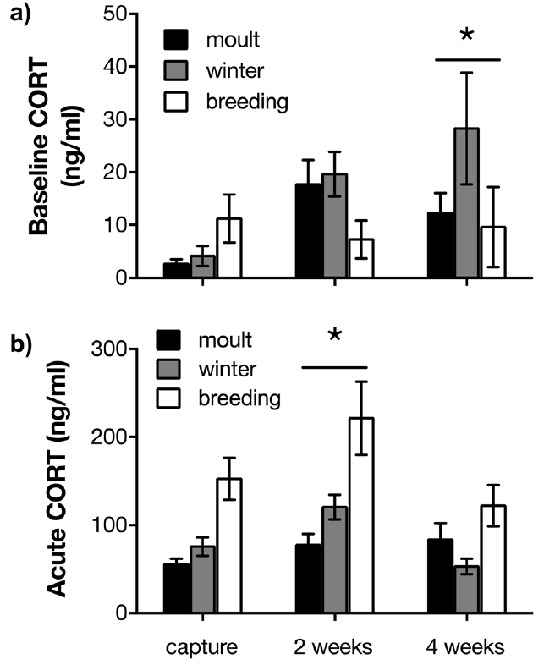
Captivity changes hormone responses in wild birds
Baseline corticosterone rose after 2 weeks relative to capture. Restraint-induced concentrations depended on both time in captivity and life-history stage, including moult, winter, and breeding. Birds also lost body mass during captivity, while recorded behaviors changed over the same period.
Lattin and colleagues followed wild house sparrows during 4 weeks of laboratory captivity. Baseline corticosterone was sampled within 3 minutes of capture or room entry; the acute stress response was sampled after 30 minutes of standardized restraint. These measurements distinguish resting hormone levels from a response to challenge.
The endocrine response changed over weeks while feeding, body mass and maintenance behavior were tracked over the same interval. Baseline secretion and the response to restraint describe different operating conditions of the stress system. Their contrasting associations with feeding connect physiological regulation to coping with a sustained environmental transition.
Lattin et al. (2019), Fig. 3(a,b). Baseline and restraint-induced corticosterone during captivity.
Lattin et al. (2019)
09
Notes:
• Baseline corticosterone rose after 2 weeks relative to capture. Restraint-induced concentrations depended on both time in captivity and life-history stage, including moult, winter, and breeding. Birds also lost body mass during captivity, while recorded behaviors changed over the same period.
• Lattin and colleagues followed wild house sparrows during 4 weeks of laboratory captivity. Baseline corticosterone was sampled within 3 minutes of capture or room entry; the acute stress response was sampled after 30 minutes of standardized restraint. These measurements distinguish resting hormone levels from a response to challenge.
• The endocrine response changed over weeks while feeding, body mass and maintenance behavior were tracked over the same interval. Baseline secretion and the response to restraint describe different operating conditions of the stress system. Their contrasting associations with feeding connect physiological regulation to coping with a sustained environmental transition.
• Seasonal categories were sampled at different times of year, so life-history stage accompanies other seasonal differences. Sampling rapidly reduces the contribution of capture disturbance to the baseline estimate. It cannot remove all earlier experiences or turn an endocrine association into a measure of subjective discomfort.
References:
Lattin CR, Merullo DP, Riters LV, Carson RE (2019). In vivo imaging of D2 receptors and corticosteroids predict behavioural responses to captivity stress in a wild bird. Scientific Reports 9: 10407. https://doi.org/10.1038/s41598-019-46845-x
Figure: Lattin et al. (2019), Fig. 3(a,b). Baseline and restraint-induced corticosterone during captivity.
Figure source: https://doi.org/10.1038/s41598-019-46845-x

Slide 10
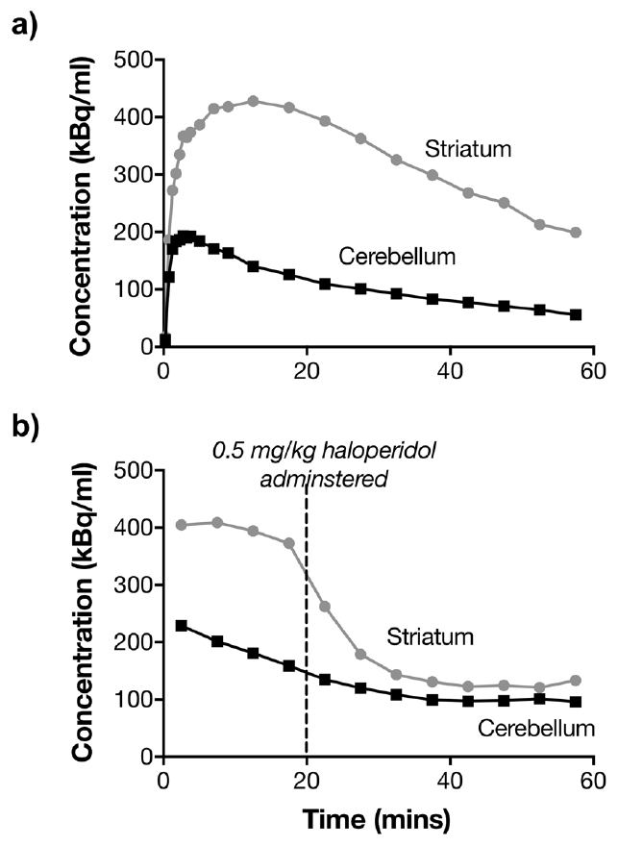
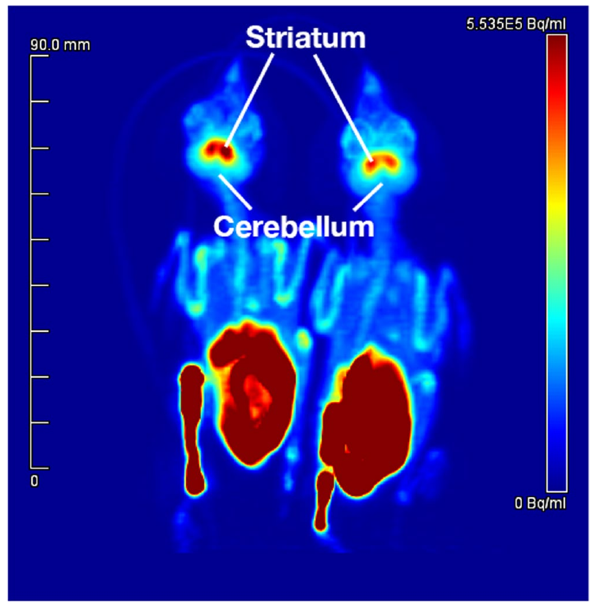
PET measures dopamine binding in sparrow striatum
Dopamine is a transmitter that modifies neural signaling through several receptor classes. The striatum is a forebrain region involved in behavior and action selection. Investigators used positron emission tomography, or PET, to localize a radioactive ligand that binds dopamine D2 receptors in living sparrows.
The ligand, carbon-11 raclopride, accumulated more strongly in striatum than in the cerebellar reference region. Giving haloperidol at 0.5 mg/kg displaced striatal binding during a scan, supporting the interpretation that the signal included receptor-specific binding rather than only nonspecific tracer distribution.
Binding potential estimates specific ligand binding relative to a region with little specific binding. Endogenous dopamine and the injected ligand compete for available receptor sites. Regional accumulation and displacement by haloperidol together identified a dopamine-receptor signal, connecting the anatomical location of the striatum with a measurable neurochemical response.
Lattin et al. (2019), Fig. 5. PET localization of striatum and cerebellum.
Lattin et al. (2019), Fig. 2(a,b). Raclopride time courses and haloperidol displacement.
Lattin et al. (2019)
10
Notes:
• Dopamine is a transmitter that modifies neural signaling through several receptor classes. The striatum is a forebrain region involved in behavior and action selection. Investigators used positron emission tomography, or PET, to localize a radioactive ligand that binds dopamine D2 receptors in living sparrows.
• The ligand, carbon-11 raclopride, accumulated more strongly in striatum than in the cerebellar reference region. Giving haloperidol at 0.5 mg/kg displaced striatal binding during a scan, supporting the interpretation that the signal included receptor-specific binding rather than only nonspecific tracer distribution.
• Binding potential estimates specific ligand binding relative to a region with little specific binding. Endogenous dopamine and the injected ligand compete for available receptor sites. Regional accumulation and displacement by haloperidol together identified a dopamine-receptor signal, connecting the anatomical location of the striatum with a measurable neurochemical response.
• The tracer was measured over a 60-minute scan in anesthetized animals. Regional localization and pharmacological displacement provide complementary checks on its interpretation. The study used a brain region with relatively little specific binding as the reference, rather than treating all radioactive signal as dopamine-receptor signal.
References:
Lattin CR, Merullo DP, Riters LV, Carson RE (2019). In vivo imaging of D2 receptors and corticosteroids predict behavioural responses to captivity stress in a wild bird. Scientific Reports 9: 10407. https://doi.org/10.1038/s41598-019-46845-x
Figure: Lattin et al. (2019), Fig. 2(a,b). Raclopride time courses and haloperidol displacement.
Figure source: https://doi.org/10.1038/s41598-019-46845-x
Figure: Lattin et al. (2019), Fig. 5. PET localization of striatum and cerebellum.
Figure source: https://doi.org/10.1038/s41598-019-46845-x

Slide 11
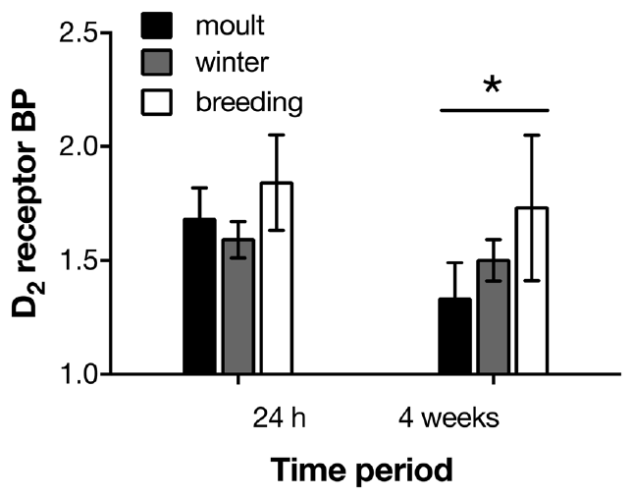
Dopamine binding changes with captivity and season
Larger declines in binding were associated with more feather ruffling and beak wiping during captivity. Higher initial binding predicted more feeding at early assessments but lower body mass later, so receptor binding did not track every behavioral and physiological endpoint in the same direction.
Sparrows underwent a first D2-receptor PET scan 24 hours after capture, with a subset scanned again after 4 weeks. Striatal binding potential decreased in moulting birds, while comparable decreases were not detected in winter or breeding birds. The neural response to captivity therefore differed by life-history stage.
Moult, winter and breeding impose different biological demands on the same species. The selective decline during moult links captivity-associated receptor binding to life-history state. Its associations with feeding and maintenance behavior further connect the striatal measurement with particular actions, while body mass provides a separate physiological outcome.
Lattin et al. (2019), Fig. 4. Striatal D2 binding after four weeks in captivity.
Lattin et al. (2019), Fig. 5. PET localization of striatum and cerebellum.
Lattin et al. (2019)
11
Notes:
• Larger declines in binding were associated with more feather ruffling and beak wiping during captivity. Higher initial binding predicted more feeding at early assessments but lower body mass later, so receptor binding did not track every behavioral and physiological endpoint in the same direction.
• Sparrows underwent a first D2-receptor PET scan 24 hours after capture, with a subset scanned again after 4 weeks. Striatal binding potential decreased in moulting birds, while comparable decreases were not detected in winter or breeding birds. The neural response to captivity therefore differed by life-history stage.
• Moult, winter and breeding impose different biological demands on the same species. The selective decline during moult links captivity-associated receptor binding to life-history state. Its associations with feeding and maintenance behavior further connect the striatal measurement with particular actions, while body mass provides a separate physiological outcome.
• Feather ruffling, beak wiping, and preening were measured separately, with different associations. Their interpretation as anxiety-related behaviors is more constrained than a direct emotional report. An observed fall in raclopride binding can have several neurochemical explanations, and the experiment did not selectively manipulate striatal receptor expression.
References:
Lattin CR, Merullo DP, Riters LV, Carson RE (2019). In vivo imaging of D2 receptors and corticosteroids predict behavioural responses to captivity stress in a wild bird. Scientific Reports 9: 10407. https://doi.org/10.1038/s41598-019-46845-x
Figure: Lattin et al. (2019), Fig. 4. Striatal D2 binding after four weeks in captivity.
Figure source: https://doi.org/10.1038/s41598-019-46845-x
Figure: Lattin et al. (2019), Fig. 5. PET localization of striatum and cerebellum.
Figure source: https://doi.org/10.1038/s41598-019-46845-x

Slide 12
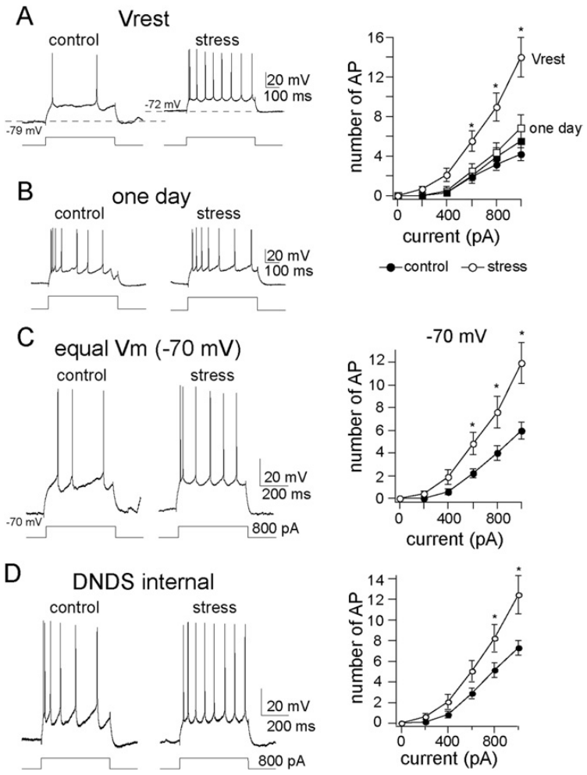
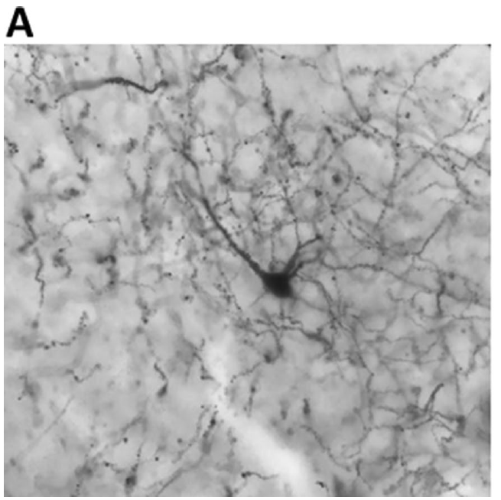
Repeated restraint increases neuronal firing gain
Current pulses lasted 800 milliseconds. Firing gain increased from 0.68 to 1.55 action potentials per 100 pA in repeatedly stressed rats. A single restraint session did not produce the same increase. Action potentials are brief regenerative electrical signals, so greater gain means more neural output for comparable injected current.
Rosenkranz and colleagues restrained male rats for 20 minutes on 7 days within a 9-day period; controls received comparable handling without restraint. Intracellular recordings then measured excitability, the number of action potentials elicited by a controlled input, in principal neurons of the lateral amygdala.
The increased spike output remained when neurons were held at −70 mV. Matching this starting voltage isolated responsiveness to the current pulse from a shift in resting potential. Repeated restraint therefore changed the transformation of depolarizing input into action potentials, increasing the gain of amygdala neuronal output.
Hegde et al. (2020), Fig. 3(A). Golgi-stained basolateral amygdala principal neuron.
Rosenkranz et al. (2010), Fig. 2(A–D). Current-evoked firing after repeated restraint.
Rosenkranz et al. (2010); Hegde et al. (2020)
12
Notes:
• Current pulses lasted 800 milliseconds. Firing gain increased from 0.68 to 1.55 action potentials per 100 pA in repeatedly stressed rats. A single restraint session did not produce the same increase. Action potentials are brief regenerative electrical signals, so greater gain means more neural output for comparable injected current.
• Rosenkranz and colleagues restrained male rats for 20 minutes on 7 days within a 9-day period; controls received comparable handling without restraint. Intracellular recordings then measured excitability, the number of action potentials elicited by a controlled input, in principal neurons of the lateral amygdala.
• The increased spike output remained when neurons were held at −70 mV. Matching this starting voltage isolated responsiveness to the current pulse from a shift in resting potential. Repeated restraint therefore changed the transformation of depolarizing input into action potentials, increasing the gain of amygdala neuronal output.
• The basolateral-amygdala anatomical context is supplied by Hegde and colleagues; Rosenkranz recorded lateral-amygdala neurons in the separate restraint experiment. Holding membrane voltage constant distinguishes starting voltage from gain during current injection. Gain describes the conversion of a defined depolarizing input into repeated neural output.
References:
Rosenkranz JA, Venheim ER, Padival M (2010). Chronic Stress Causes Amygdala Hyperexcitability in Rodents. Biological Psychiatry 67: 1128-1136. https://doi.org/10.1016/j.biopsych.2010.02.008
Hegde A, Suresh S, Mitra R (2020). Early-life short-term environmental enrichment counteracts the effects of stress on anxiety-like behavior, brain-derived neurotrophic factor and nuclear translocation of glucocorticoid receptors in the basolateral amygdala. Scientific Reports 10: 14053. https://doi.org/10.1038/s41598-020-70875-5
Figure: Rosenkranz et al. (2010), Fig. 2(A–D). Current-evoked firing after repeated restraint.
Figure source: https://doi.org/10.1016/j.biopsych.2010.02.008
Figure: Hegde et al. (2020), Fig. 3(A). Golgi-stained basolateral amygdala principal neuron.
Figure source: https://doi.org/10.1038/s41598-020-70875-5

Slide 13
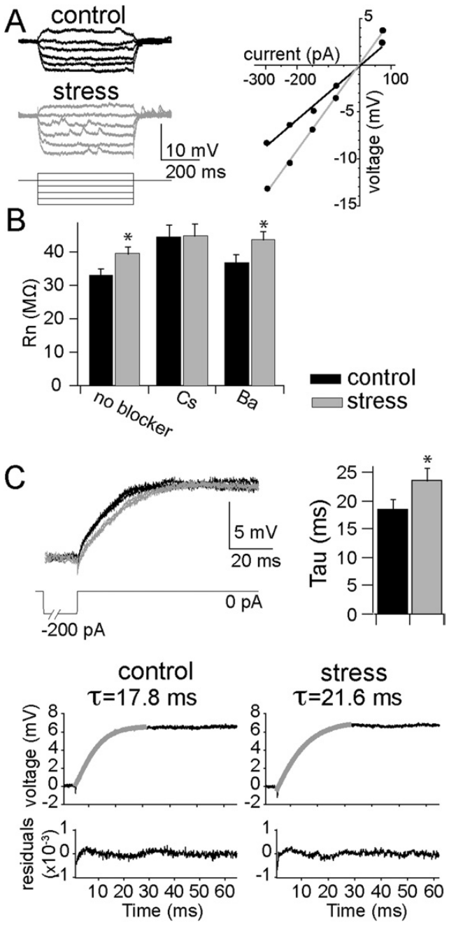
Resting membrane changes do not explain all stress effects
Input resistance describes how strongly a neuron’s membrane voltage changes for a small injected current. Repeatedly stressed rats had increased input resistance in lateral-amygdala neurons, and the membrane time constant was longer, indicating a changed response to subthreshold inputs that do not trigger spikes.
However, matching voltage and examining these passive properties did not account for the full increase in spike output. Blocking fast inhibitory inputs through GABA-A-related chloride conductances also left a stress-related excitability difference. GABA-A receptors are transmitter-gated channels that contribute to rapid inhibitory signaling in this preparation.
Input resistance governs the size of a subthreshold voltage response, while the membrane time constant governs its duration. Spike generation additionally depends on active conductances recruited during firing. The persistent difference after the tested inhibitory blockade directed the explanation toward intrinsic regulation of action-potential output.
Hegde et al. (2020), Fig. 3(A). Golgi-stained basolateral amygdala principal neuron.
Rosenkranz et al. (2010), Fig. 3(A–D). Input resistance, voltage responses and membrane time constant.
Rosenkranz et al. (2010); Hegde et al. (2020)
13
Notes:
• Input resistance describes how strongly a neuron’s membrane voltage changes for a small injected current. Repeatedly stressed rats had increased input resistance in lateral-amygdala neurons, and the membrane time constant was longer, indicating a changed response to subthreshold inputs that do not trigger spikes.
• However, matching voltage and examining these passive properties did not account for the full increase in spike output. Blocking fast inhibitory inputs through GABA-A-related chloride conductances also left a stress-related excitability difference. GABA-A receptors are transmitter-gated channels that contribute to rapid inhibitory signaling in this preparation.
• Input resistance governs the size of a subthreshold voltage response, while the membrane time constant governs its duration. Spike generation additionally depends on active conductances recruited during firing. The persistent difference after the tested inhibitory blockade directed the explanation toward intrinsic regulation of action-potential output.
• Passive voltage responses and action-potential generation occur in different operating ranges of the membrane. The experiment compared responses below spike threshold as well as firing during depolarizing pulses. Blocking a receptor-related conductance in the recorded cell tests a particular mechanism; it does not remove every inhibitory pathway in the animal.
References:
Rosenkranz JA, Venheim ER, Padival M (2010). Chronic Stress Causes Amygdala Hyperexcitability in Rodents. Biological Psychiatry 67: 1128-1136. https://doi.org/10.1016/j.biopsych.2010.02.008
Hegde A, Suresh S, Mitra R (2020). Early-life short-term environmental enrichment counteracts the effects of stress on anxiety-like behavior, brain-derived neurotrophic factor and nuclear translocation of glucocorticoid receptors in the basolateral amygdala. Scientific Reports 10: 14053. https://doi.org/10.1038/s41598-020-70875-5
Figure: Rosenkranz et al. (2010), Fig. 3(A–D). Input resistance, voltage responses and membrane time constant.
Figure source: https://doi.org/10.1016/j.biopsych.2010.02.008
Figure: Hegde et al. (2020), Fig. 3(A). Golgi-stained basolateral amygdala principal neuron.
Figure source: https://doi.org/10.1038/s41598-020-70875-5

Slide 14
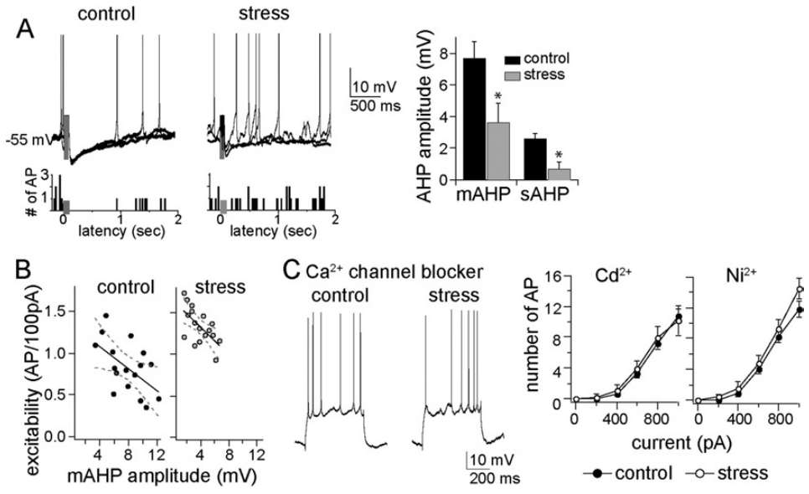
Stress weakens the brake after a burst of spikes
An afterhyperpolarization is a period of more negative membrane voltage after spiking that restrains further firing. Calcium entering during activity can activate potassium channels; outward potassium current then contributes to this brake. The medium and slow afterhyperpolarizations were reduced after repeated restraint.
The slow component averaged 2.6 mV in controls and 0.7 mV in stressed rats. Pharmacologically blocking calcium entry reduced the afterhyperpolarization and diminished the excitability difference between groups. These interventions support a calcium-dependent contribution to the stress-related increase in firing.
The fast voltage recovery after a single spike remained comparatively unchanged, while the medium and slow brakes following a burst were weakened. A smaller post-burst potassium-dependent brake permits additional spikes during sustained input. The stress effect therefore concerned the temporal regulation of repeated firing rather than every phase of the action potential.
Rosenkranz et al. (2010), Fig. 5(A–D). Afterhyperpolarization and calcium-channel blockade.
Hegde et al. (2020), Fig. 3(A). Golgi-stained basolateral amygdala principal neuron.
Rosenkranz et al. (2010); Hegde et al. (2020)
14
Notes:
• An afterhyperpolarization is a period of more negative membrane voltage after spiking that restrains further firing. Calcium entering during activity can activate potassium channels; outward potassium current then contributes to this brake. The medium and slow afterhyperpolarizations were reduced after repeated restraint.
• The slow component averaged 2.6 mV in controls and 0.7 mV in stressed rats. Pharmacologically blocking calcium entry reduced the afterhyperpolarization and diminished the excitability difference between groups. These interventions support a calcium-dependent contribution to the stress-related increase in firing.
• The fast voltage recovery after a single spike remained comparatively unchanged, while the medium and slow brakes following a burst were weakened. A smaller post-burst potassium-dependent brake permits additional spikes during sustained input. The stress effect therefore concerned the temporal regulation of repeated firing rather than every phase of the action potential.
• A weaker afterhyperpolarization allows a similar depolarizing drive to produce additional spikes because the post-burst voltage brake is smaller. The fast afterhyperpolarization after a single spike did not show the same clear group difference. This constrains the explanation rather than supporting a claim that every potassium-dependent process was impaired.
References:
Rosenkranz JA, Venheim ER, Padival M (2010). Chronic Stress Causes Amygdala Hyperexcitability in Rodents. Biological Psychiatry 67: 1128-1136. https://doi.org/10.1016/j.biopsych.2010.02.008
Hegde A, Suresh S, Mitra R (2020). Early-life short-term environmental enrichment counteracts the effects of stress on anxiety-like behavior, brain-derived neurotrophic factor and nuclear translocation of glucocorticoid receptors in the basolateral amygdala. Scientific Reports 10: 14053. https://doi.org/10.1038/s41598-020-70875-5
Figure: Rosenkranz et al. (2010), Fig. 5(A–D). Afterhyperpolarization and calcium-channel blockade.
Figure source: https://doi.org/10.1016/j.biopsych.2010.02.008
Figure: Hegde et al. (2020), Fig. 3(A). Golgi-stained basolateral amygdala principal neuron.
Figure source: https://doi.org/10.1038/s41598-020-70875-5

Slide 15
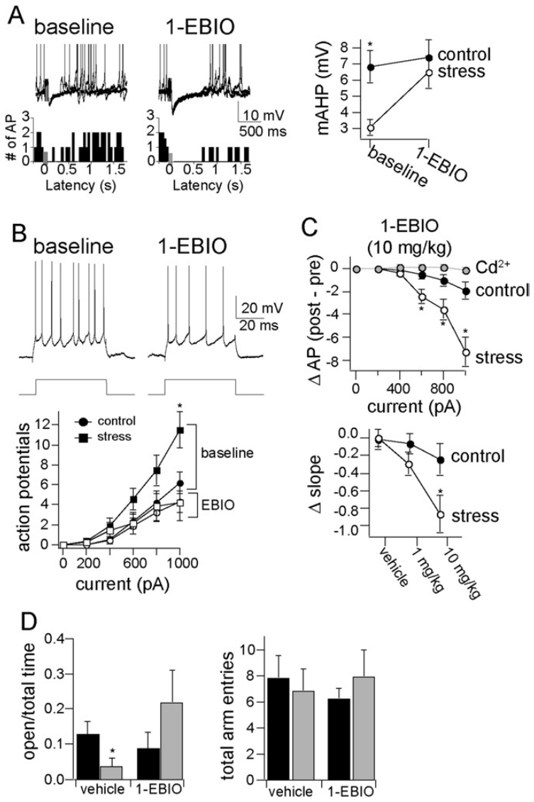
Enhancing the spike brake reverses hyperexcitability
The investigators administered 1-EBIO, a compound that enhances calcium-activated potassium-channel activity, after recording baseline excitability. At 10 mg/kg it increased the medium afterhyperpolarization and reduced excessive spike output in stressed rats toward the control range. Vehicle-treated animals provided a comparison for injection effects.
The same systemic treatment also altered elevated-plus-maze behavior. Repeatedly stressed vehicle-treated rats spent about 10 seconds in open arms, whereas treated stressed rats spent about 65 seconds. Total arm entries did not show a corresponding group difference, limiting a simple explanation based on general movement.
Enhancing the potassium-dependent brake restored a larger afterhyperpolarization and reduced spike output. The parallel increase in open-arm exploration occurred without a corresponding increase in total arm entries. Channel modulation thus altered both sustained neuronal responsiveness and the distribution of exploratory behavior under the tested stress conditions.
Hegde et al. (2020), Fig. 3(A). Golgi-stained basolateral amygdala principal neuron.
Rosenkranz et al. (2010), Fig. 6(A–D). 1-EBIO effects on firing and open-arm exploration.
Rosenkranz et al. (2010); Hegde et al. (2020)
15
Notes:
• The investigators administered 1-EBIO, a compound that enhances calcium-activated potassium-channel activity, after recording baseline excitability. At 10 mg/kg it increased the medium afterhyperpolarization and reduced excessive spike output in stressed rats toward the control range. Vehicle-treated animals provided a comparison for injection effects.
• The same systemic treatment also altered elevated-plus-maze behavior. Repeatedly stressed vehicle-treated rats spent about 10 seconds in open arms, whereas treated stressed rats spent about 65 seconds. Total arm entries did not show a corresponding group difference, limiting a simple explanation based on general movement.
• Enhancing the potassium-dependent brake restored a larger afterhyperpolarization and reduced spike output. The parallel increase in open-arm exploration occurred without a corresponding increase in total arm entries. Channel modulation thus altered both sustained neuronal responsiveness and the distribution of exploratory behavior under the tested stress conditions.
• The electrophysiological effect was sensitive to calcium-channel manipulation within the recorded neuron, strengthening the cellular interpretation. The behavioral intervention still acts throughout the animal. Open-arm exploration is an operational anxiety-related measure, and the study did not demonstrate a treatment for all forms of captivity-associated repetitive behavior.
References:
Rosenkranz JA, Venheim ER, Padival M (2010). Chronic Stress Causes Amygdala Hyperexcitability in Rodents. Biological Psychiatry 67: 1128-1136. https://doi.org/10.1016/j.biopsych.2010.02.008
Hegde A, Suresh S, Mitra R (2020). Early-life short-term environmental enrichment counteracts the effects of stress on anxiety-like behavior, brain-derived neurotrophic factor and nuclear translocation of glucocorticoid receptors in the basolateral amygdala. Scientific Reports 10: 14053. https://doi.org/10.1038/s41598-020-70875-5
Figure: Rosenkranz et al. (2010), Fig. 6(A–D). 1-EBIO effects on firing and open-arm exploration.
Figure source: https://doi.org/10.1016/j.biopsych.2010.02.008
Figure: Hegde et al. (2020), Fig. 3(A). Golgi-stained basolateral amygdala principal neuron.
Figure source: https://doi.org/10.1038/s41598-020-70875-5

Slide 16
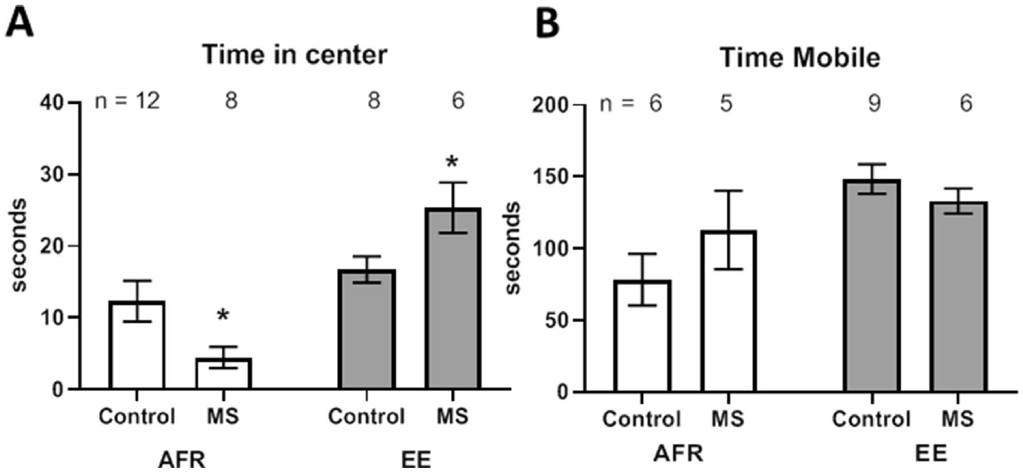
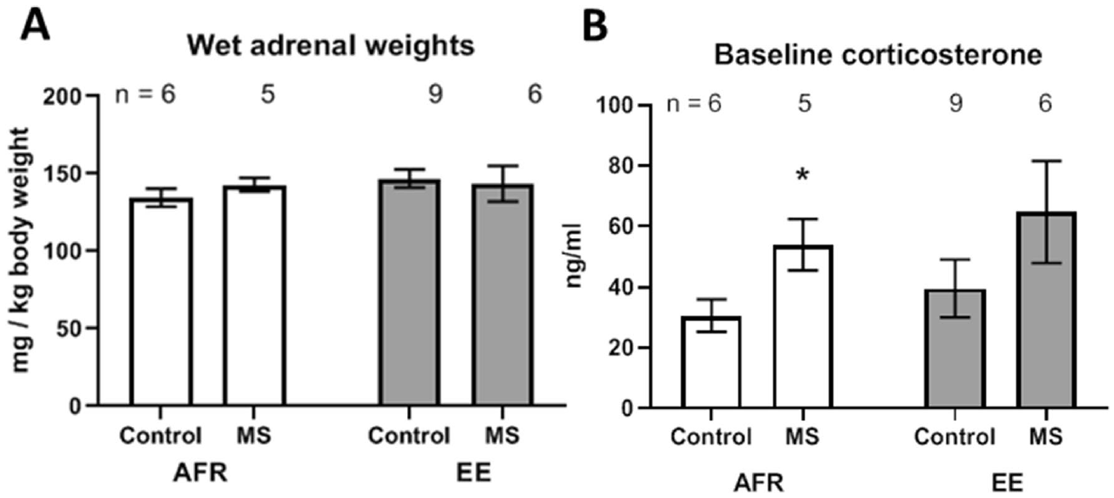
Early enrichment alters later responses to separation
Pre-weaning enrichment increased adult exploration of the open-field center, while early separation reduced center exploration in standard housing. Total mobility did not differ clearly between separation groups. Adult corticosterone outcomes were also housing-dependent, although endocrine effects were not uniformly eliminated across every comparison.
Hegde and colleagues separated rat pups from dams for 3 hours daily between postnatal days 2 and 14. Enriched housing was provided from days 2 through 21, after which treatments ended. Adult testing at days 60–70 compared separation and enrichment in a crossed experimental design.
The enriched exposure ended at weaning, well before adult testing. Space, climbing resources, changing objects and food variation supplied repeated sensory and motor experience during development. The dam shared these conditions with the litter, so the early environment included maternal interactions as well as the pups’ direct use of resources.
Hegde et al. (2020), Fig. 2(A,B). Adult open-field behavior and mobility.
Hegde et al. (2020), Fig. 1(A,B). Adult endocrine outcomes after pre-weaning treatments.
Hegde et al. (2020)
16
Notes:
• Pre-weaning enrichment increased adult exploration of the open-field center, while early separation reduced center exploration in standard housing. Total mobility did not differ clearly between separation groups. Adult corticosterone outcomes were also housing-dependent, although endocrine effects were not uniformly eliminated across every comparison.
• Hegde and colleagues separated rat pups from dams for 3 hours daily between postnatal days 2 and 14. Enriched housing was provided from days 2 through 21, after which treatments ended. Adult testing at days 60–70 compared separation and enrichment in a crossed experimental design.
• The enriched exposure ended at weaning, well before adult testing. Space, climbing resources, changing objects and food variation supplied repeated sensory and motor experience during development. The dam shared these conditions with the litter, so the early environment included maternal interactions as well as the pups’ direct use of resources.
• The dam and litter shared the enriched cage, so altered maternal interactions may contribute alongside direct sensory experience of the pups. A heating pad was used during separation. The investigators measured adult outcomes after the enriched exposure had ended, separating early experience from a resource present during the behavioral test.
References:
Hegde A, Suresh S, Mitra R (2020). Early-life short-term environmental enrichment counteracts the effects of stress on anxiety-like behavior, brain-derived neurotrophic factor and nuclear translocation of glucocorticoid receptors in the basolateral amygdala. Scientific Reports 10: 14053. https://doi.org/10.1038/s41598-020-70875-5
Figure: Hegde et al. (2020), Fig. 2(A,B). Adult open-field behavior and mobility.
Figure source: https://doi.org/10.1038/s41598-020-70875-5
Figure: Hegde et al. (2020), Fig. 1(A,B). Adult endocrine outcomes after pre-weaning treatments.
Figure source: https://doi.org/10.1038/s41598-020-70875-5

Slide 17
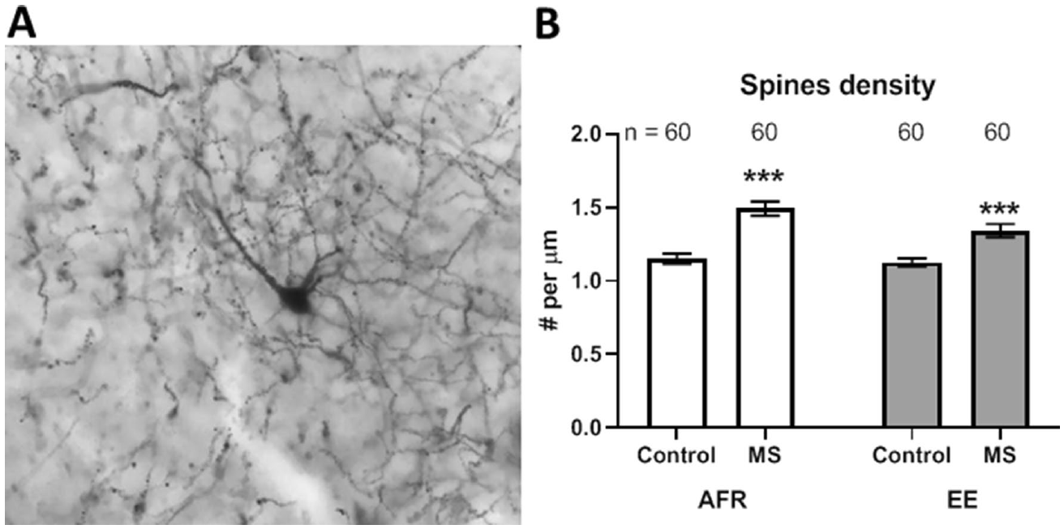
Early stress and enrichment alter dendritic spines
Dendrites receive neuronal inputs, and dendritic spines are small protrusions that commonly host excitatory synapses. Golgi staining visualized principal neurons in the basolateral amygdala. Investigators counted spines along 60 µm segments of primary and secondary dendrites in adulthood.
Early maternal separation increased spine density under both standard and enriched rearing conditions. Enrichment shifted density downward overall but did not abolish the separation-associated increase. The structural outcome therefore differed from a simple description in which enrichment completely erased every stress effect.
Primary dendrites emerge from the cell body, and secondary dendrites branch from them. Counting spines per micrometre measures the density of potential input sites along each sampled segment. Early separation and enrichment shifted this local structure in opposing directions, producing an adult anatomical pattern that retained both developmental influences.
Hegde et al. (2020), Fig. 3(A,B). Basolateral amygdala neurons and dendritic spine density.
Hegde et al. (2020)
17
Notes:
• Dendrites receive neuronal inputs, and dendritic spines are small protrusions that commonly host excitatory synapses. Golgi staining visualized principal neurons in the basolateral amygdala. Investigators counted spines along 60 µm segments of primary and secondary dendrites in adulthood.
• Early maternal separation increased spine density under both standard and enriched rearing conditions. Enrichment shifted density downward overall but did not abolish the separation-associated increase. The structural outcome therefore differed from a simple description in which enrichment completely erased every stress effect.
• Primary dendrites emerge from the cell body, and secondary dendrites branch from them. Counting spines per micrometre measures the density of potential input sites along each sampled segment. Early separation and enrichment shifted this local structure in opposing directions, producing an adult anatomical pattern that retained both developmental influences.
• Primary dendrites originate at the cell body; secondary dendrites branch from primary dendrites. The counts were expressed per micrometre, preserving the distinction between density and total dendritic extent. The stained neuron supplies anatomical context, while the density comparison quantifies a specific structural feature rather than total amygdala size.
References:
Hegde A, Suresh S, Mitra R (2020). Early-life short-term environmental enrichment counteracts the effects of stress on anxiety-like behavior, brain-derived neurotrophic factor and nuclear translocation of glucocorticoid receptors in the basolateral amygdala. Scientific Reports 10: 14053. https://doi.org/10.1038/s41598-020-70875-5
Figure: Hegde et al. (2020), Fig. 3(A,B). Basolateral amygdala neurons and dendritic spine density.
Figure source: https://doi.org/10.1038/s41598-020-70875-5

Slide 18
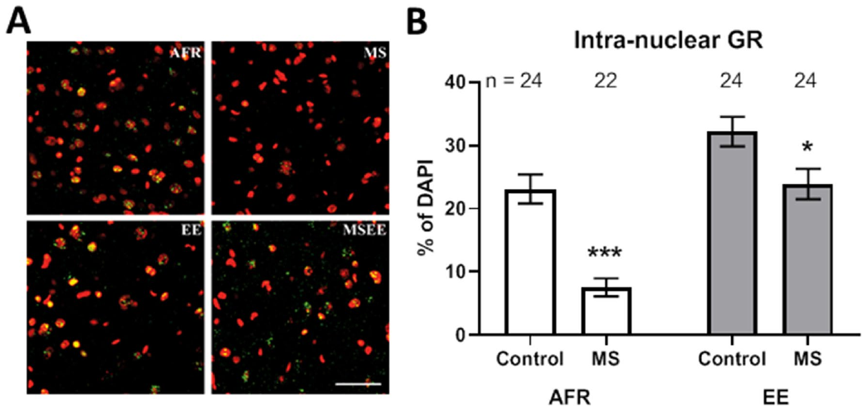
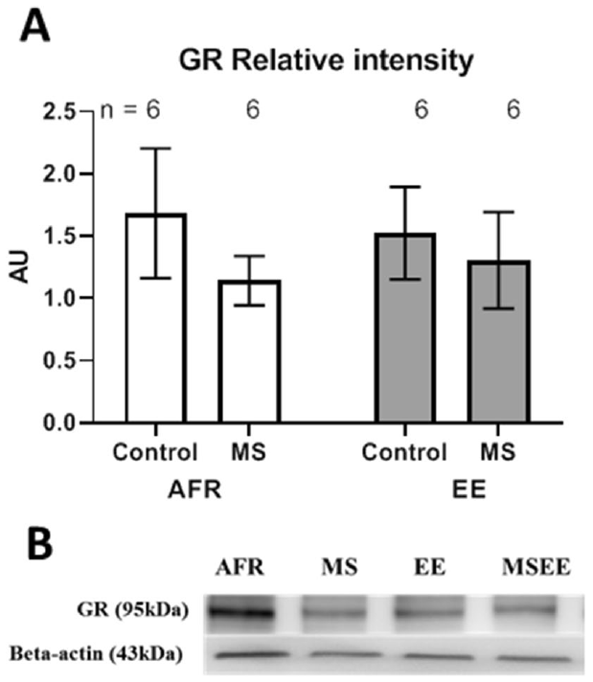
Receptor localization changes without a protein increase
A glucocorticoid receptor, or GR, is an intracellular receptor whose nuclear localization can influence gene regulation. Investigators immunolabeled GR and identified nuclei with a DNA stain in adult basolateral-amygdala sections. They measured the fraction of nuclei containing detectable GR signal.
Early separation reduced the fraction with nuclear GR, while enrichment had an opposing effect. Total GR protein measured in tissue extracts did not differ clearly across the same treatment comparisons. Receptor location within cells can therefore change without a corresponding detectable increase in overall protein abundance.
The DNA stain identified nuclei, and receptor labeling identified GR signal within those nuclei. Tissue extracts instead combined protein across cellular compartments. Separation and enrichment changed the nuclear fraction while total protein remained similar, linking early experience to where the receptor was located within adult amygdala cells.
Hegde et al. (2020), Fig. 4(A,B). Glucocorticoid receptor localization in amygdala cells.
Hegde et al. (2020), Fig. 5(A,B). Total glucocorticoid receptor protein.
Hegde et al. (2020)
18
Notes:
• A glucocorticoid receptor, or GR, is an intracellular receptor whose nuclear localization can influence gene regulation. Investigators immunolabeled GR and identified nuclei with a DNA stain in adult basolateral-amygdala sections. They measured the fraction of nuclei containing detectable GR signal.
• Early separation reduced the fraction with nuclear GR, while enrichment had an opposing effect. Total GR protein measured in tissue extracts did not differ clearly across the same treatment comparisons. Receptor location within cells can therefore change without a corresponding detectable increase in overall protein abundance.
• The DNA stain identified nuclei, and receptor labeling identified GR signal within those nuclei. Tissue extracts instead combined protein across cellular compartments. Separation and enrichment changed the nuclear fraction while total protein remained similar, linking early experience to where the receptor was located within adult amygdala cells.
• Nuclear colocalization and tissue protein abundance sample different levels of organization. A change in receptor location can alter access to nuclear gene regulation even when pooled protein remains comparable. The experiment measured localization at an adult endpoint rather than tracking individual receptors in real time.
References:
Hegde A, Suresh S, Mitra R (2020). Early-life short-term environmental enrichment counteracts the effects of stress on anxiety-like behavior, brain-derived neurotrophic factor and nuclear translocation of glucocorticoid receptors in the basolateral amygdala. Scientific Reports 10: 14053. https://doi.org/10.1038/s41598-020-70875-5
Figure: Hegde et al. (2020), Fig. 4(A,B). Glucocorticoid receptor localization in amygdala cells.
Figure source: https://doi.org/10.1038/s41598-020-70875-5
Figure: Hegde et al. (2020), Fig. 5(A,B). Total glucocorticoid receptor protein.
Figure source: https://doi.org/10.1038/s41598-020-70875-5

Slide 19
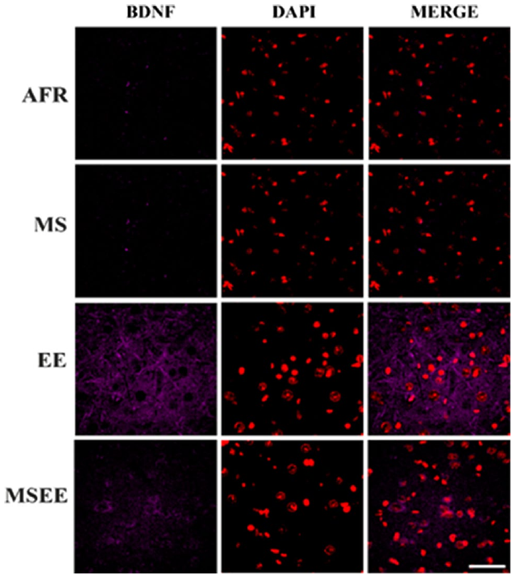
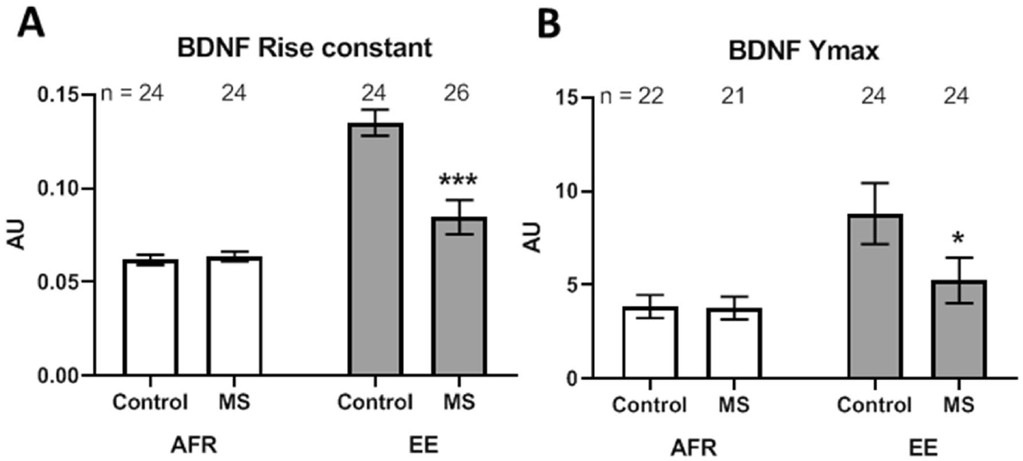
Enrichment changes a plasticity-related protein signal
Brain-derived neurotrophic factor, or BDNF, is a signaling protein associated with neuronal growth and synaptic plasticity. Adult basolateral-amygdala tissue was immunolabeled after the early separation and enrichment treatments. The researchers quantified fluorescence distributions rather than relying only on visible appearance.
Pre-weaning enrichment changed the extent and intensity distribution of BDNF labeling. Separation modified these effects in enriched animals, while some comparisons in standard housing showed no clear difference. A separate tissue-protein assay did not yield the same simple overall enrichment effect across every endpoint.
Fluorescence distributions capture both the extent of labeled tissue and the intensity of its signal. A tissue extract pools protein across that spatial arrangement. The authors’ hypothesis links the enrichment-associated BDNF pattern to later plasticity and behavioral resilience, connecting developmental experience with the adult molecular environment of the amygdala.
Hegde et al. (2020), Fig. 7. BDNF immunolabelling in basolateral amygdala.
Hegde et al. (2020), Fig. 8(A,B). Quantification of BDNF fluorescence.
Hegde et al. (2020)
19
Notes:
• Brain-derived neurotrophic factor, or BDNF, is a signaling protein associated with neuronal growth and synaptic plasticity. Adult basolateral-amygdala tissue was immunolabeled after the early separation and enrichment treatments. The researchers quantified fluorescence distributions rather than relying only on visible appearance.
• Pre-weaning enrichment changed the extent and intensity distribution of BDNF labeling. Separation modified these effects in enriched animals, while some comparisons in standard housing showed no clear difference. A separate tissue-protein assay did not yield the same simple overall enrichment effect across every endpoint.
• Fluorescence distributions capture both the extent of labeled tissue and the intensity of its signal. A tissue extract pools protein across that spatial arrangement. The authors’ hypothesis links the enrichment-associated BDNF pattern to later plasticity and behavioral resilience, connecting developmental experience with the adult molecular environment of the amygdala.
• Fluorescence intensity and total protein abundance respond differently to the spatial distribution of a molecular signal. The study compared both measurements after the same developmental treatments. The BDNF connection to resilience is a hypothesis because BDNF itself was not selectively manipulated.
References:
Hegde A, Suresh S, Mitra R (2020). Early-life short-term environmental enrichment counteracts the effects of stress on anxiety-like behavior, brain-derived neurotrophic factor and nuclear translocation of glucocorticoid receptors in the basolateral amygdala. Scientific Reports 10: 14053. https://doi.org/10.1038/s41598-020-70875-5
Figure: Hegde et al. (2020), Fig. 7. BDNF immunolabelling in basolateral amygdala.
Figure source: https://doi.org/10.1038/s41598-020-70875-5
Figure: Hegde et al. (2020), Fig. 8(A,B). Quantification of BDNF fluorescence.
Figure source: https://doi.org/10.1038/s41598-020-70875-5

Slide 20
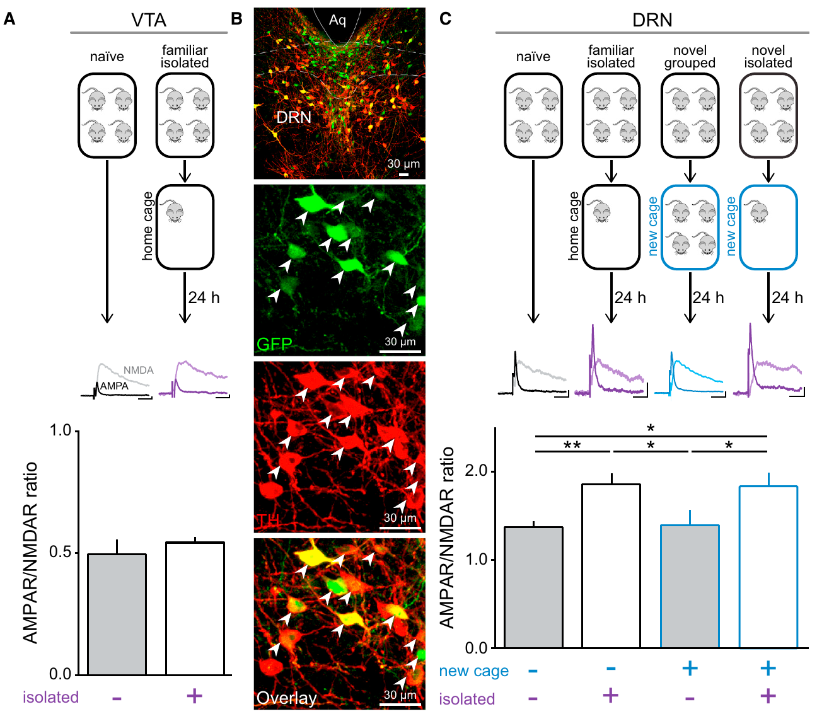
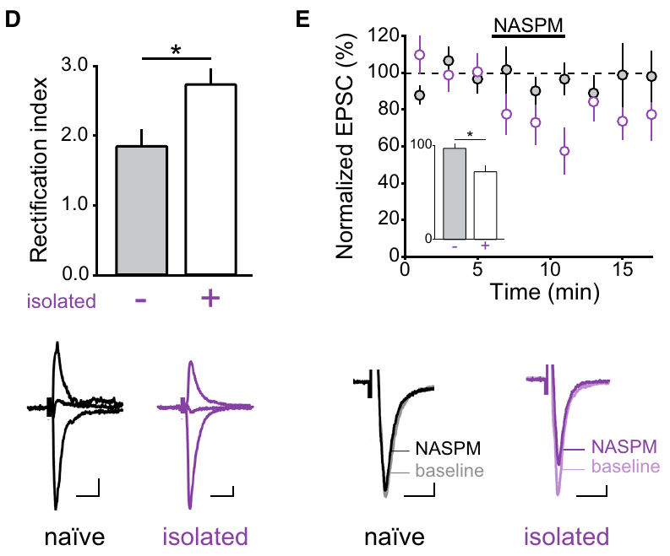
A day of isolation changes excitatory synapses
Matthews and colleagues isolated mice from cage mates for 24 hours, then recorded identified dopamine neurons in the dorsal raphe nucleus, a midbrain region. They measured glutamate-evoked currents through AMPA and NMDA receptors, two receptor classes that support excitatory synaptic signaling.
The AMPA-to-NMDA current ratio increased in dorsal-raphe dopamine neurons after isolation, including when isolation occurred in the familiar home cage. A comparable change was not detected in the sampled ventral-tegmental dopamine neurons. A novel cage without isolation did not reproduce the same increase.
Rectification is an asymmetric dependence of current flow on membrane voltage. The authors’ hypothesis was that isolation increased AMPA receptors lacking the GluR2 subunit, which permits calcium entry. Preferential suppression by NASPM and altered rectification supported that receptor contribution, linking social conditions to the properties of excitatory synapses.
Matthews et al. (2016), Fig. 1(A–C). Dopamine-neuron identification and synaptic current ratios.
Matthews et al. (2016), Fig. 1(D,E). Rectification and NASPM sensitivity after isolation.
Matthews et al. (2016)
20
Notes:
• Matthews and colleagues isolated mice from cage mates for 24 hours, then recorded identified dopamine neurons in the dorsal raphe nucleus, a midbrain region. They measured glutamate-evoked currents through AMPA and NMDA receptors, two receptor classes that support excitatory synaptic signaling.
• The AMPA-to-NMDA current ratio increased in dorsal-raphe dopamine neurons after isolation, including when isolation occurred in the familiar home cage. A comparable change was not detected in the sampled ventral-tegmental dopamine neurons. A novel cage without isolation did not reproduce the same increase.
• Rectification is an asymmetric dependence of current flow on membrane voltage. The authors’ hypothesis was that isolation increased AMPA receptors lacking the GluR2 subunit, which permits calcium entry. Preferential suppression by NASPM and altered rectification supported that receptor contribution, linking social conditions to the properties of excitatory synapses.
• NASPM preferentially blocks the tested calcium-permeable AMPA-receptor contribution. The familiar-cage control separates absence of companions from novelty of the physical enclosure. The study measured synaptic currents after isolation; it did not establish that every dopamine neuron or every glutamate synapse changed in the same way.
References:
Matthews GA, Nieh EH, Vander Weele CM, Halbert SA, Pradhan RV, Yosafat AS, Glober GF, Izadmehr EM, Thomas RE, Lacy GD, Wildes CP, Ungless MA, Tye KM (2016). Dorsal Raphe Dopamine Neurons Represent the Experience of Social Isolation. Cell 164: 617-631. https://doi.org/10.1016/j.cell.2015.12.040
Figure: Matthews et al. (2016), Fig. 1(A–C). Dopamine-neuron identification and synaptic current ratios.
Figure source: https://doi.org/10.1016/j.cell.2015.12.040
Figure: Matthews et al. (2016), Fig. 1(D,E). Rectification and NASPM sensitivity after isolation.
Figure source: https://doi.org/10.1016/j.cell.2015.12.040

Slide 21
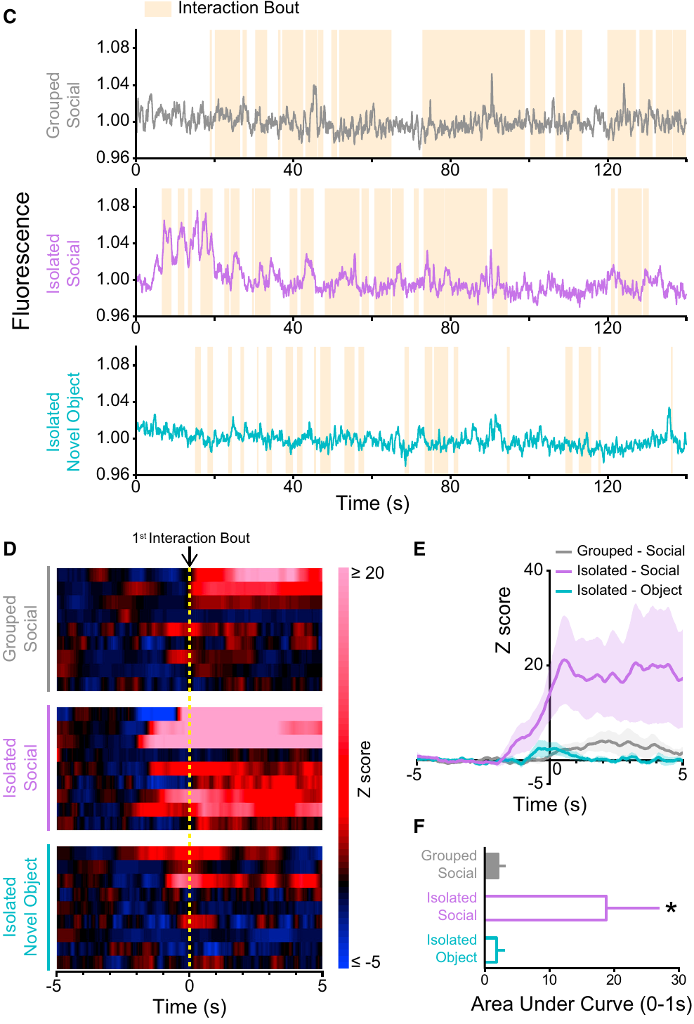
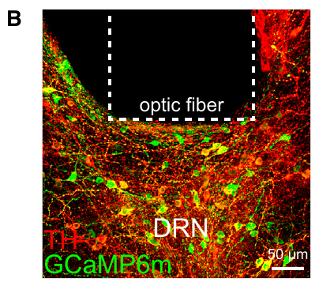
Raphe activity tracks reunion after isolation
After 24 hours of isolation, initial social contact produced larger calcium responses than contact after group housing. The population signal was aligned to interaction bouts, allowing neural responses to be compared with the timing of behavior. The authors also compared responses to a novel object.
Fiber photometry samples fluorescent signals from a population of labeled neurons through an implanted optical fiber. GCaMP6m, a calcium-sensitive fluorescent protein, was expressed in dorsal-raphe dopamine neurons. Calcium changes provided an indirect measure of activity during interactions with another mouse.
The calcium signal rose around initial social interaction after isolation, connecting the timing of neuronal recruitment to reunion. The authors’ hypothesis is that this population promotes contact that alleviates an isolation-associated state. The stronger response after separation places recent social history within the circuit’s response to another animal.
Matthews et al. (2016), Fig. 2(C–F). Calcium responses during social contact after isolation.
Matthews et al. (2016), Fig. 2(B). Calcium-indicator expression and optic-fiber placement in dorsal raphe.
Matthews et al. (2016)
21
Notes:
• After 24 hours of isolation, initial social contact produced larger calcium responses than contact after group housing. The population signal was aligned to interaction bouts, allowing neural responses to be compared with the timing of behavior. The authors also compared responses to a novel object.
• Fiber photometry samples fluorescent signals from a population of labeled neurons through an implanted optical fiber. GCaMP6m, a calcium-sensitive fluorescent protein, was expressed in dorsal-raphe dopamine neurons. Calcium changes provided an indirect measure of activity during interactions with another mouse.
• The calcium signal rose around initial social interaction after isolation, connecting the timing of neuronal recruitment to reunion. The authors’ hypothesis is that this population promotes contact that alleviates an isolation-associated state. The stronger response after separation places recent social history within the circuit’s response to another animal.
• The indicator’s fluorescence depends on intracellular calcium, so it is a proxy rather than an action-potential recording. Population averaging can hide neurons with opposing responses. Social and object comparisons constrain a general novelty explanation, while the exact neural representation remains broader than any single emotional label.
References:
Matthews GA, Nieh EH, Vander Weele CM, Halbert SA, Pradhan RV, Yosafat AS, Glober GF, Izadmehr EM, Thomas RE, Lacy GD, Wildes CP, Ungless MA, Tye KM (2016). Dorsal Raphe Dopamine Neurons Represent the Experience of Social Isolation. Cell 164: 617-631. https://doi.org/10.1016/j.cell.2015.12.040
Figure: Matthews et al. (2016), Fig. 2(C–F). Calcium responses during social contact after isolation.
Figure source: https://doi.org/10.1016/j.cell.2015.12.040
Figure: Matthews et al. (2016), Fig. 2(B). Calcium-indicator expression and optic-fiber placement in dorsal raphe.
Figure source: https://doi.org/10.1016/j.cell.2015.12.040

Slide 22
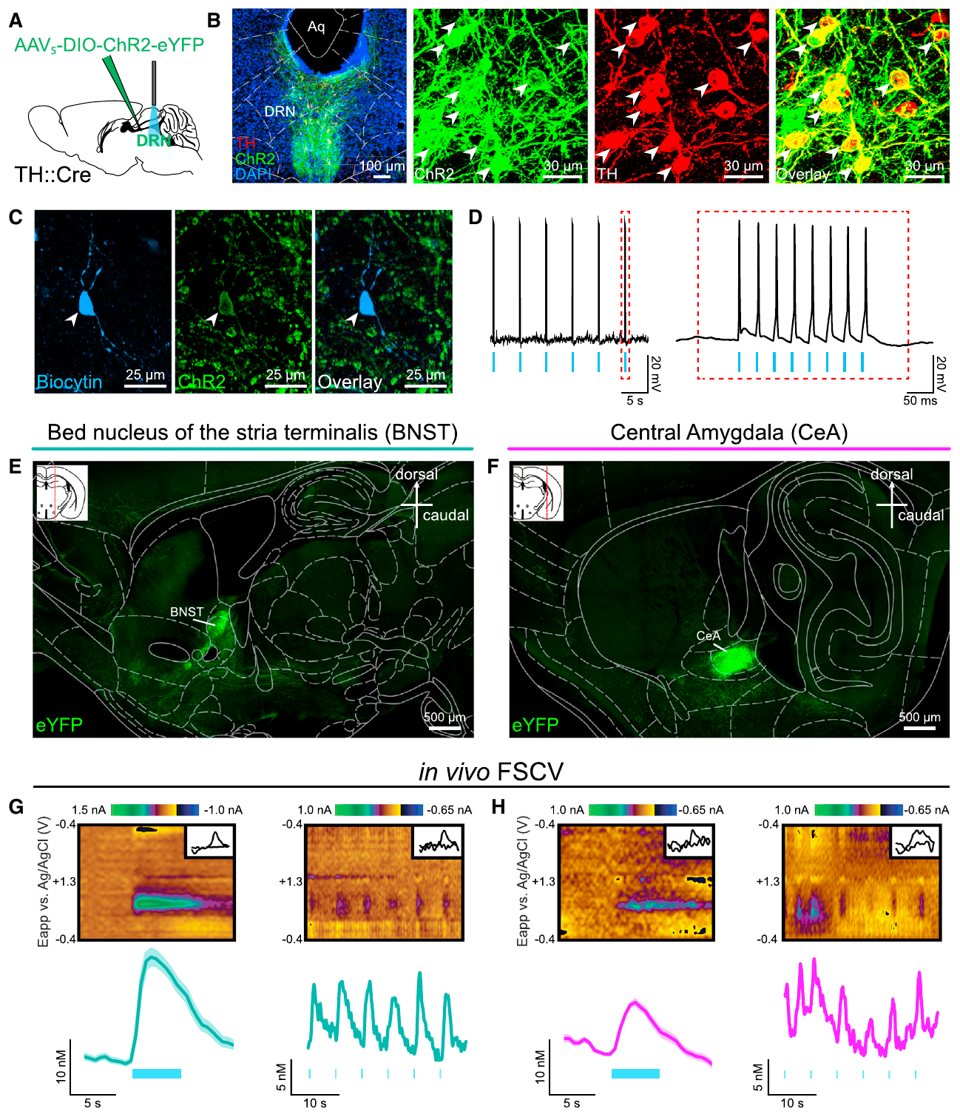
Raphe dopamine neurons signal to forebrain targets
Optogenetics uses a light-sensitive protein to control selected neurons. Channelrhodopsin-2, a light-gated cation channel, was expressed in dorsal-raphe dopamine neurons. Blue-light pulses depolarized the cells and evoked action potentials, connecting a defined intervention to neuronal output.
Labeled axons reached the bed nucleus of the stria terminalis and the central amygdala, forebrain regions involved in behavioral state and threat-related processing. Fast-scan cyclic voltammetry, an electrochemical measurement, detected dopamine release in these targets during stimulation with 5-millisecond light pulses.
Axonal labeling identified the target regions, and stimulation-induced dopamine release confirmed that the projections carried a transmitter output. Light-gated cation entry first depolarized the manipulated neurons, and brief pulses then recruited their axons. This sequence connected cellular activation with neurochemical signaling in the forebrain targets.
Matthews et al. (2016), Fig. 3(A–H). Dopamine-neuron anatomy, projections and evoked dopamine release.
Matthews et al. (2016)
22
Notes:
• Optogenetics uses a light-sensitive protein to control selected neurons. Channelrhodopsin-2, a light-gated cation channel, was expressed in dorsal-raphe dopamine neurons. Blue-light pulses depolarized the cells and evoked action potentials, connecting a defined intervention to neuronal output.
• Labeled axons reached the bed nucleus of the stria terminalis and the central amygdala, forebrain regions involved in behavioral state and threat-related processing. Fast-scan cyclic voltammetry, an electrochemical measurement, detected dopamine release in these targets during stimulation with 5-millisecond light pulses.
• Axonal labeling identified the target regions, and stimulation-induced dopamine release confirmed that the projections carried a transmitter output. Light-gated cation entry first depolarized the manipulated neurons, and brief pulses then recruited their axons. This sequence connected cellular activation with neurochemical signaling in the forebrain targets.
• Brief voltage sweeps at a recording electrode identify a dopamine-associated electrochemical signal. The published target-region images supply the anatomical location of the projections. Detecting release confirms a transmitter output, but assigning a behavioral role to one projection would require an intervention that selectively isolates that projection.
References:
Matthews GA, Nieh EH, Vander Weele CM, Halbert SA, Pradhan RV, Yosafat AS, Glober GF, Izadmehr EM, Thomas RE, Lacy GD, Wildes CP, Ungless MA, Tye KM (2016). Dorsal Raphe Dopamine Neurons Represent the Experience of Social Isolation. Cell 164: 617-631. https://doi.org/10.1016/j.cell.2015.12.040
Figure: Matthews et al. (2016), Fig. 3(A–H). Dopamine-neuron anatomy, projections and evoked dopamine release.
Figure source: https://doi.org/10.1016/j.cell.2015.12.040

Slide 23
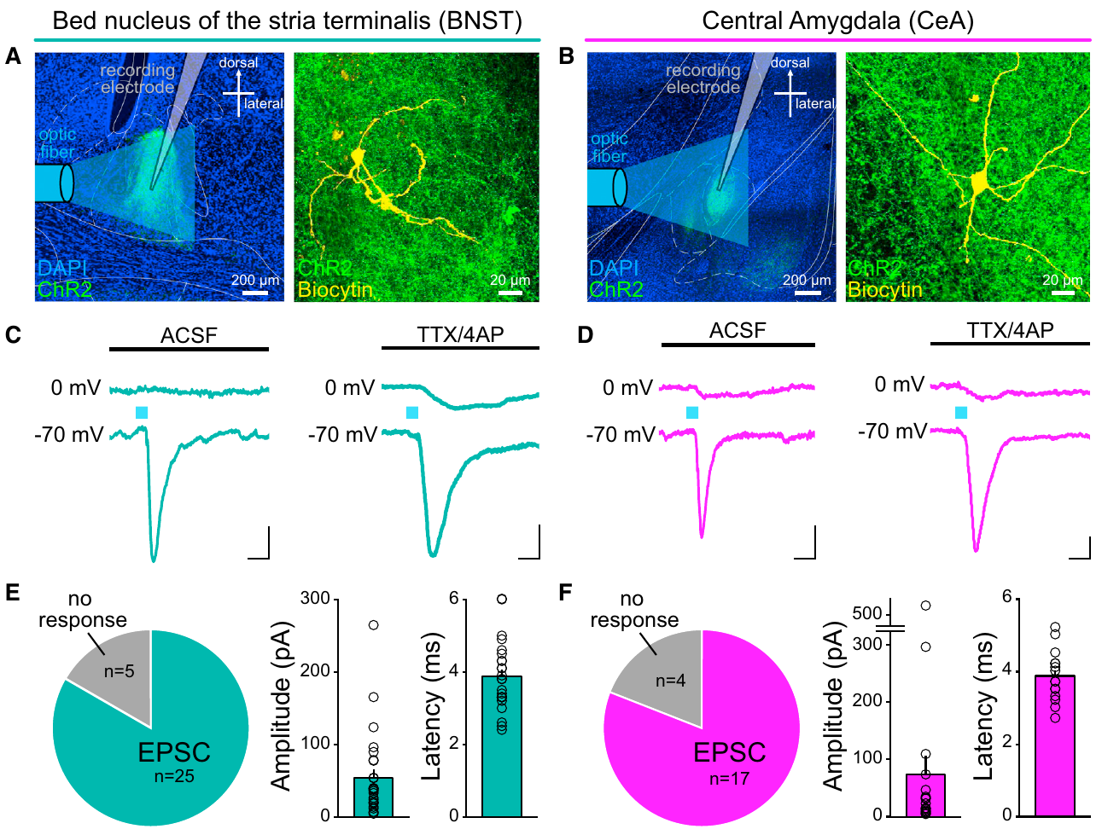
Dopamine neurons can also release glutamate
Dorsal-raphe dopamine neurons were not limited to dopamine transmission. Optical stimulation of their axon terminals evoked rapid excitatory postsynaptic currents, electrical currents in target cells driven by excitatory synaptic input. Recordings were made in the bed nucleus of the stria terminalis and central amygdala.
A 5-millisecond light pulse evoked short-latency currents recorded at −70 mV. The currents persisted with tetrodotoxin and 4-aminopyridine, a combination used to test direct terminal-mediated transmission, and were consistent with glutamate release. Slower inhibitory responses reflected additional local circuit recruitment.
Co-transmission means a defined neuronal population communicates through more than one transmitter. Tetrodotoxin blocked sodium-dependent spikes, while potassium-channel blockade allowed illuminated terminals to release transmitter directly. The surviving excitatory currents identified a fast glutamatergic connection alongside the dopamine output of this raphe population.
Matthews et al. (2016), Fig. 4(A–F). Target-region anatomy and optically evoked excitatory currents.
Matthews et al. (2016)
23
Notes:
• Dorsal-raphe dopamine neurons were not limited to dopamine transmission. Optical stimulation of their axon terminals evoked rapid excitatory postsynaptic currents, electrical currents in target cells driven by excitatory synaptic input. Recordings were made in the bed nucleus of the stria terminalis and central amygdala.
• A 5-millisecond light pulse evoked short-latency currents recorded at −70 mV. The currents persisted with tetrodotoxin and 4-aminopyridine, a combination used to test direct terminal-mediated transmission, and were consistent with glutamate release. Slower inhibitory responses reflected additional local circuit recruitment.
• Co-transmission means a defined neuronal population communicates through more than one transmitter. Tetrodotoxin blocked sodium-dependent spikes, while potassium-channel blockade allowed illuminated terminals to release transmitter directly. The surviving excitatory currents identified a fast glutamatergic connection alongside the dopamine output of this raphe population.
• Tetrodotoxin blocks voltage-gated sodium-channel-dependent spikes; 4-aminopyridine blocks potassium currents and permits sufficiently depolarized illuminated terminals to release transmitter. Persistence under that condition supports a direct connection rather than a chain of intervening spikes. It does not imply that the two transmitters act at identical receptors or timescales.
References:
Matthews GA, Nieh EH, Vander Weele CM, Halbert SA, Pradhan RV, Yosafat AS, Glober GF, Izadmehr EM, Thomas RE, Lacy GD, Wildes CP, Ungless MA, Tye KM (2016). Dorsal Raphe Dopamine Neurons Represent the Experience of Social Isolation. Cell 164: 617-631. https://doi.org/10.1016/j.cell.2015.12.040
Figure: Matthews et al. (2016), Fig. 4(A–F). Target-region anatomy and optically evoked excitatory currents.
Figure source: https://doi.org/10.1016/j.cell.2015.12.040

Slide 24
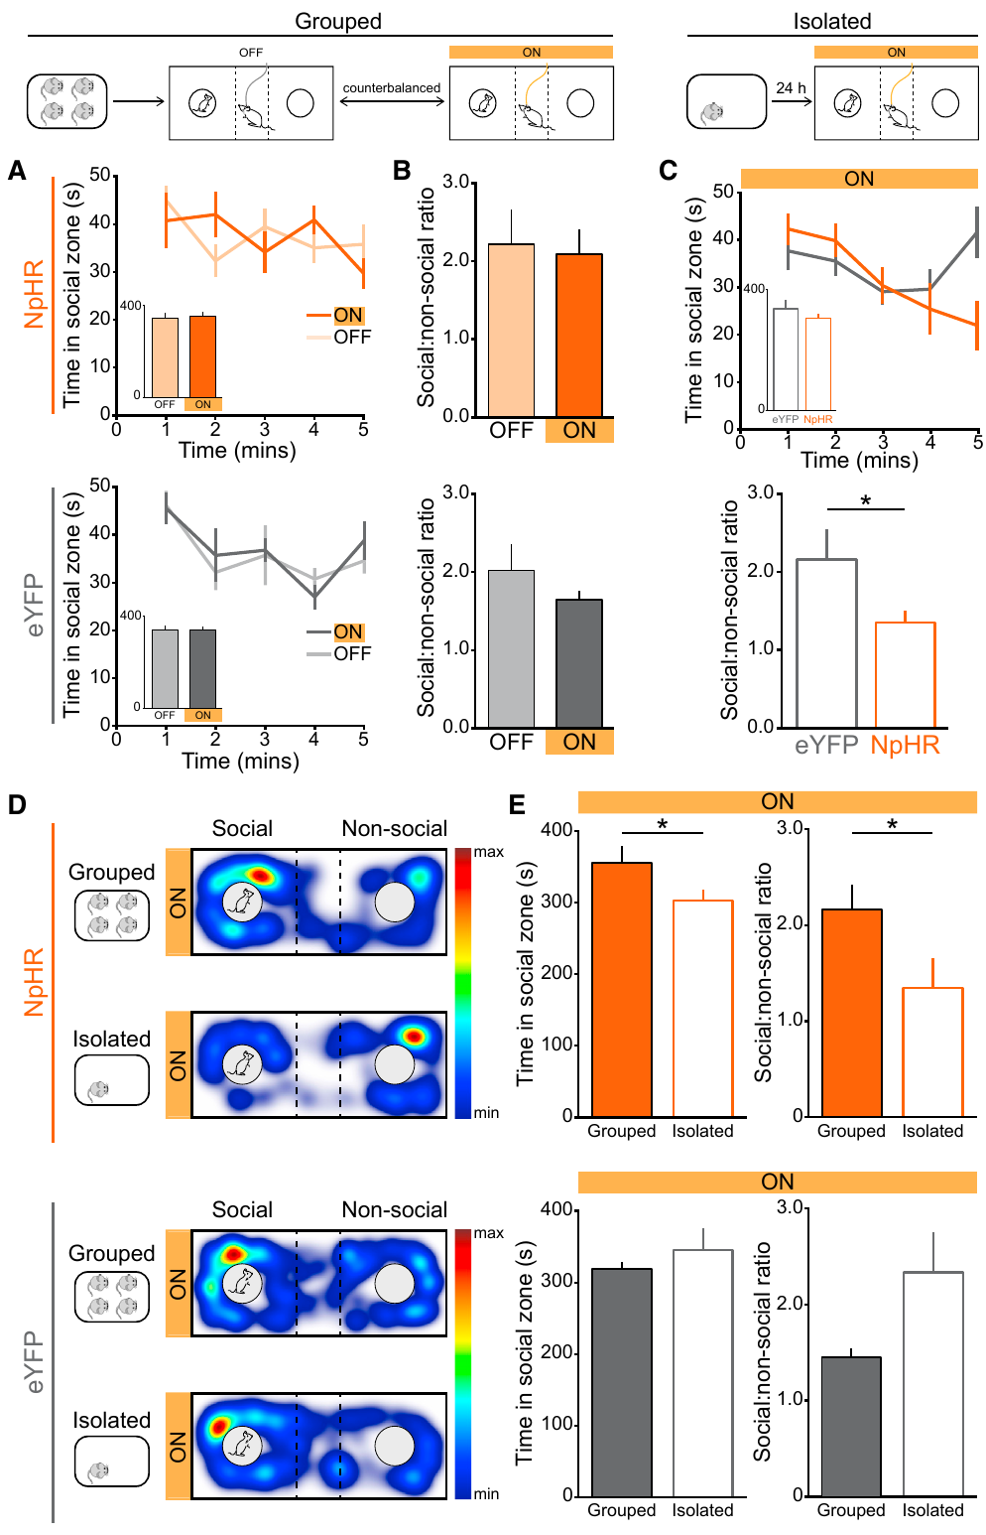
Silencing raphe neurons affects isolated mice differently
Inhibition reduced social preference after isolation but did not produce the same detectable effect in group-housed mice. Spatial heat maps and time in the social zone captured behavior during the task. The circuit’s contribution therefore depended on the preceding social condition.
The investigators expressed halorhodopsin, a light-driven inhibitory protein, in dorsal-raphe dopamine neurons. They compared social preference while the same mice were group-housed and after 24 hours of isolation. Fluorescent-protein controls received light without the inhibitory protein.
Activating the same population increased social approach but also produced avoidance of a stimulation-associated place. Social seeking and positive reinforcement were therefore separable outcomes. The authors’ hypothesis is that these neurons recruit actions that reduce an aversive isolation-associated state, with their behavioral contribution changing according to recent social experience.
Matthews et al. (2016), Fig. 6(A–E). Social preference during dopamine-neuron inhibition.
Matthews et al. (2016), Fig. 2(B). Calcium-indicator expression and optic-fiber placement in dorsal raphe.
Matthews et al. (2016)
24
Notes:
• Inhibition reduced social preference after isolation but did not produce the same detectable effect in group-housed mice. Spatial heat maps and time in the social zone captured behavior during the task. The circuit’s contribution therefore depended on the preceding social condition.
• The investigators expressed halorhodopsin, a light-driven inhibitory protein, in dorsal-raphe dopamine neurons. They compared social preference while the same mice were group-housed and after 24 hours of isolation. Fluorescent-protein controls received light without the inhibitory protein.
• Activating the same population increased social approach but also produced avoidance of a stimulation-associated place. Social seeking and positive reinforcement were therefore separable outcomes. The authors’ hypothesis is that these neurons recruit actions that reduce an aversive isolation-associated state, with their behavioral contribution changing according to recent social experience.
• Necessity depends on the tested condition: reduced social preference after silencing does not mean that these neurons control every social encounter. The fluorescent-protein controls address effects of light delivery and handling. Activation and inhibition examine complementary questions, and neither manipulation alone establishes the subjective feeling accompanying the behavior.
References:
Matthews GA, Nieh EH, Vander Weele CM, Halbert SA, Pradhan RV, Yosafat AS, Glober GF, Izadmehr EM, Thomas RE, Lacy GD, Wildes CP, Ungless MA, Tye KM (2016). Dorsal Raphe Dopamine Neurons Represent the Experience of Social Isolation. Cell 164: 617-631. https://doi.org/10.1016/j.cell.2015.12.040
Figure: Matthews et al. (2016), Fig. 6(A–E). Social preference during dopamine-neuron inhibition.
Figure source: https://doi.org/10.1016/j.cell.2015.12.040
Figure: Matthews et al. (2016), Fig. 2(B). Calcium-indicator expression and optic-fiber placement in dorsal raphe.
Figure source: https://doi.org/10.1016/j.cell.2015.12.040

Slide 25
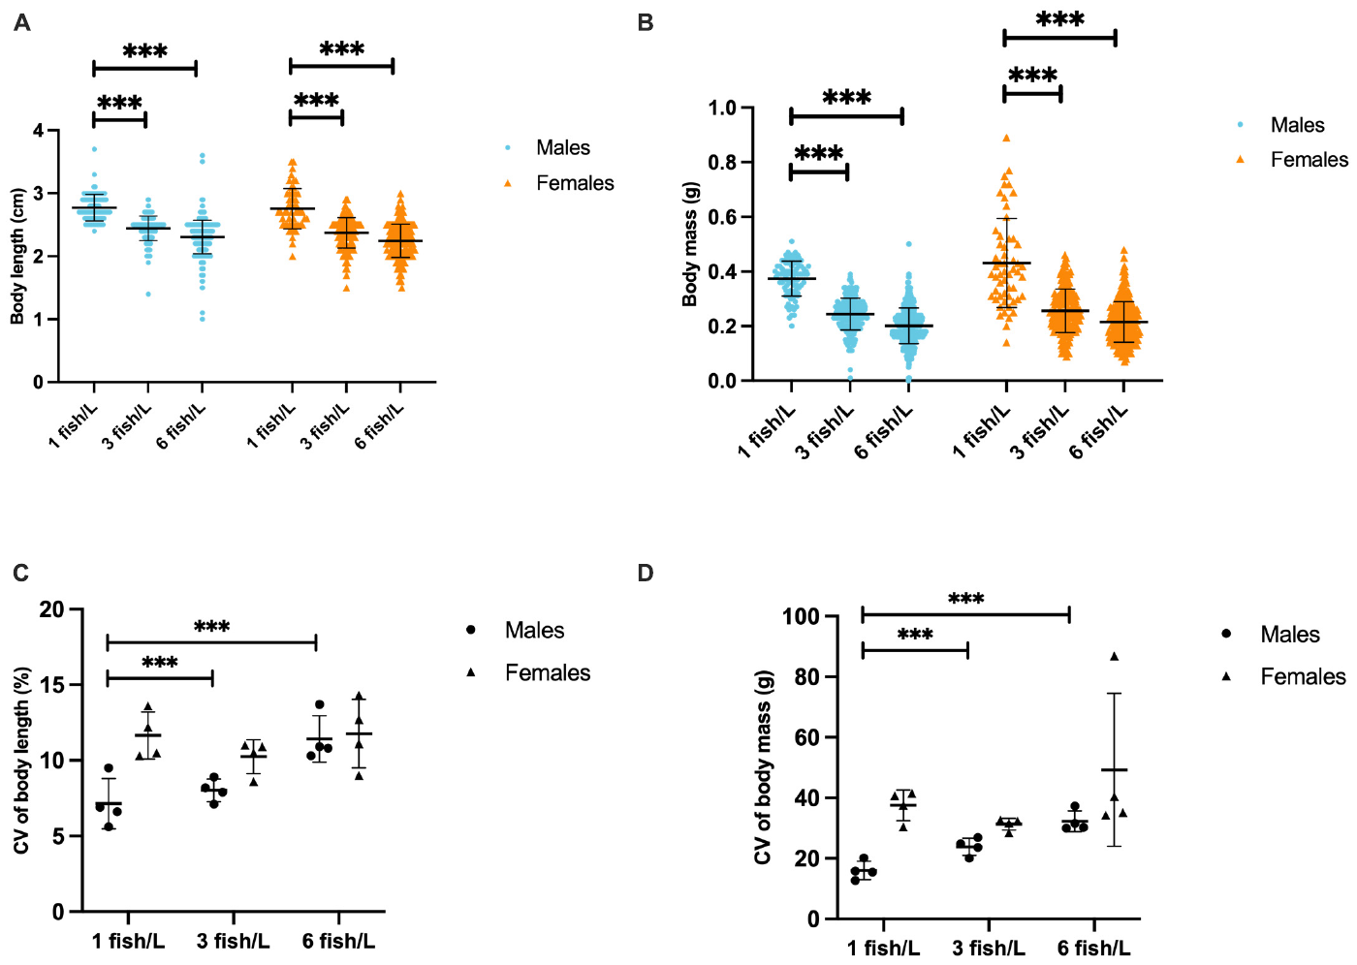
Lower fish density does not guarantee better welfare
Sen Sarma and colleagues reared zebrafish at 1, 3, or 6 fish/L with barren, gravel, plant, or gravel-plus-plant conditions. Stocking density is the number of fish per unit of water volume. Growth, aggression, endocrine responses, and behavior were measured to compare several consequences of these housing conditions.
Fish reared at 1 fish/L were longer and heavier than those at the higher densities. This growth result might appear favorable when considered alone. However, the same low-density groups also expressed more aggression and stronger cortisol release during a group challenge.
The growth and social outcomes diverged within the same housing comparison. More length and mass at 1 fish/L accompanied more attacks and stronger group-challenge cortisol release. Density changed a network of biological outcomes, connecting nutritional growth with the social interactions occurring around those growing fish.
Sen Sarma et al. (2023), Fig. 1(A–D). Growth across stocking densities.
Sen Sarma et al. (2023)
25
Notes:
• Sen Sarma and colleagues reared zebrafish at 1, 3, or 6 fish/L with barren, gravel, plant, or gravel-plus-plant conditions. Stocking density is the number of fish per unit of water volume. Growth, aggression, endocrine responses, and behavior were measured to compare several consequences of these housing conditions.
• Fish reared at 1 fish/L were longer and heavier than those at the higher densities. This growth result might appear favorable when considered alone. However, the same low-density groups also expressed more aggression and stronger cortisol release during a group challenge.
• The growth and social outcomes diverged within the same housing comparison. More length and mass at 1 fish/L accompanied more attacks and stronger group-challenge cortisol release. Density changed a network of biological outcomes, connecting nutritional growth with the social interactions occurring around those growing fish.
• The published figure separates males and females and reports growth directly. Density was crossed with several enrichment categories, allowing the investigators to examine their contributions separately. An overall recommendation needs to consider the adverse social and endocrine outcomes alongside growth rather than selecting the most convenient single endpoint.
References:
Sen Sarma O, Frymus N, Axling F, Thörnqvist PO, Roman E, Winberg S (2023). Optimizing zebrafish rearing−Effects of fish density and environmental enrichment. Frontiers in Behavioral Neuroscience 17: 1204021. https://doi.org/10.3389/fnbeh.2023.1204021
Figure: Sen Sarma et al. (2023), Fig. 1(A–D). Growth across stocking densities.
Figure source: https://doi.org/10.3389/fnbeh.2023.1204021

Slide 26
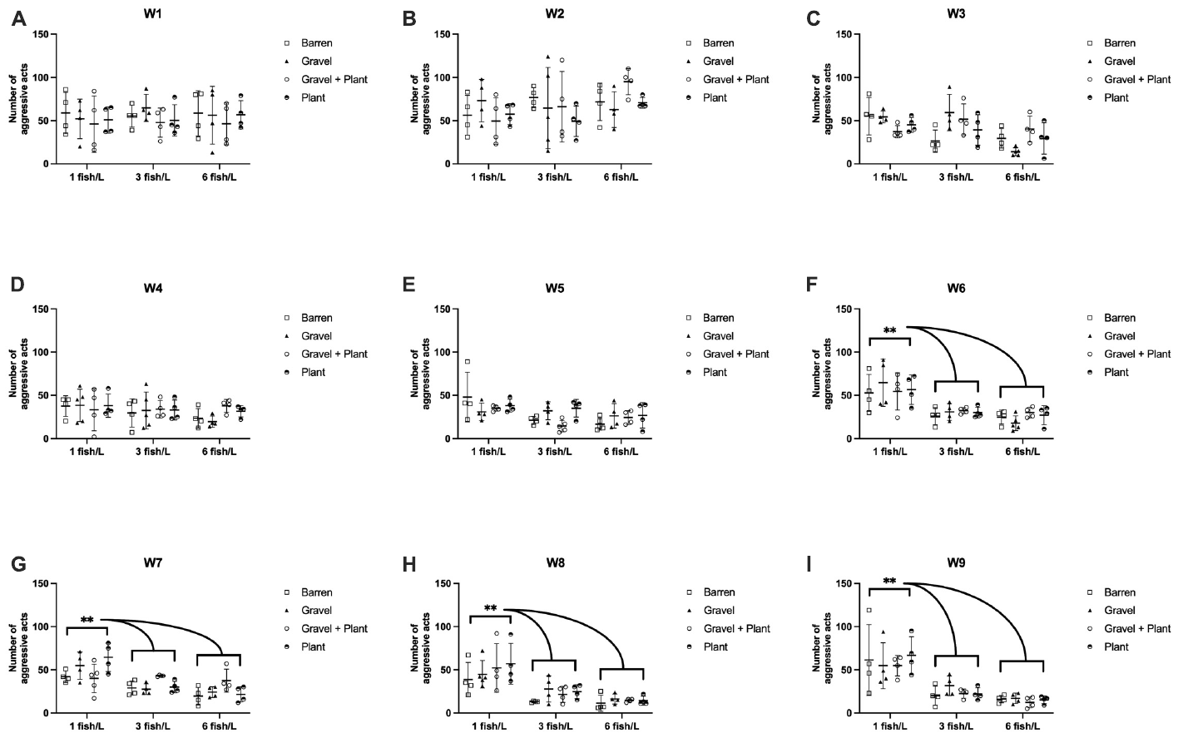
Sparse zebrafish groups can become more aggressive
Agonistic behavior includes aggressive acts and related social interactions. During 9 weeks of rearing, observers scored zebrafish strikes, chases, and occasional circling. Comparisons used the same stocking densities and the four physical-enrichment conditions used for growth measurements.
Aggression was higher at 1 fish/L than at 3 or 6 fish/L, with differences emerging across repeated weekly observations. The tested gravel and plant treatments did not produce a clear overall reduction. Merely adding an object was therefore not equivalent to demonstrating a reduction in social conflict.
Most aggressive acts were strikes and chases, and observers recorded little active hiding in the plants. The authors’ hypothesis is that sparse groups allowed persistent dominance-related interactions. The tested objects supplied physical complexity but rarely served as observed refuges, connecting their actual use with the continued expression of aggression.
Sen Sarma et al. (2023), Fig. 2(A–I). Weekly aggressive acts across stocking densities.
Sen Sarma et al. (2023)
26
Notes:
• Agonistic behavior includes aggressive acts and related social interactions. During 9 weeks of rearing, observers scored zebrafish strikes, chases, and occasional circling. Comparisons used the same stocking densities and the four physical-enrichment conditions used for growth measurements.
• Aggression was higher at 1 fish/L than at 3 or 6 fish/L, with differences emerging across repeated weekly observations. The tested gravel and plant treatments did not produce a clear overall reduction. Merely adding an object was therefore not equivalent to demonstrating a reduction in social conflict.
• Most aggressive acts were strikes and chases, and observers recorded little active hiding in the plants. The authors’ hypothesis is that sparse groups allowed persistent dominance-related interactions. The tested objects supplied physical complexity but rarely served as observed refuges, connecting their actual use with the continued expression of aggression.
• Most observed acts were strikes and chases rather than prolonged fights. Observers recorded very little active hiding in the plants, limiting an assumption that the plant necessarily functioned as an effective refuge. The result concerns the particular objects, densities, tank conditions, and rearing period tested.
References:
Sen Sarma O, Frymus N, Axling F, Thörnqvist PO, Roman E, Winberg S (2023). Optimizing zebrafish rearing−Effects of fish density and environmental enrichment. Frontiers in Behavioral Neuroscience 17: 1204021. https://doi.org/10.3389/fnbeh.2023.1204021
Figure: Sen Sarma et al. (2023), Fig. 2(A–I). Weekly aggressive acts across stocking densities.
Figure source: https://doi.org/10.3389/fnbeh.2023.1204021

Slide 27
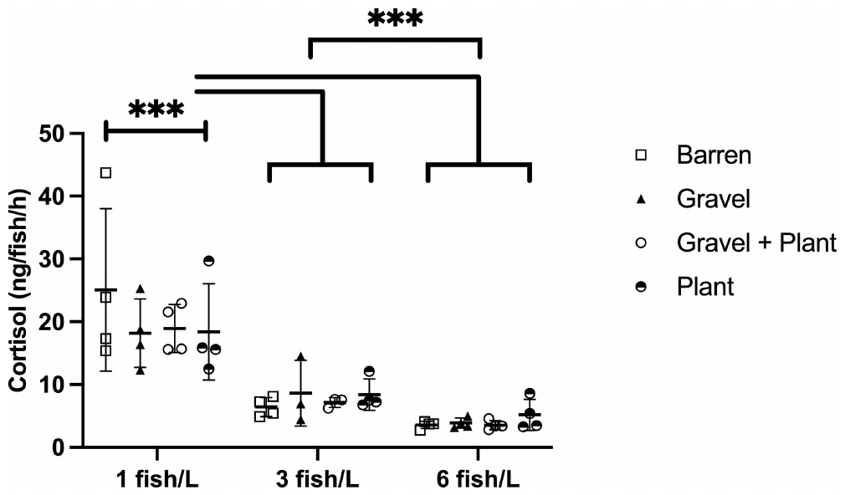
Group confinement exposes housing-dependent stress
Groups reared at 1 fish/L released more cortisol than groups at 3 or 6 fish/L; the 6 fish/L groups released the least under this challenge. The observed secretion range was 2.7–43.7 ng/fish/h. The tested enrichment conditions did not yield a clear additional effect.
Cortisol is a principal stress-associated glucocorticoid in zebrafish. To challenge groups, researchers lowered tank water to 1 cm for 30 minutes and then extracted cortisol released into the water. Release was expressed per fish per hour rather than as a blood concentration.
The group challenge maintained contact among fish while sharply reducing available water depth. Cortisol recovered from the water was divided by the number of fish and collection time. This readout linked the rearing history to endocrine output during a shared confinement event in which social interactions remained possible.
Sen Sarma et al. (2023), Fig. 3. Cortisol release after group confinement.
Sen Sarma et al. (2023)
27
Notes:
• Groups reared at 1 fish/L released more cortisol than groups at 3 or 6 fish/L; the 6 fish/L groups released the least under this challenge. The observed secretion range was 2.7–43.7 ng/fish/h. The tested enrichment conditions did not yield a clear additional effect.
• Cortisol is a principal stress-associated glucocorticoid in zebrafish. To challenge groups, researchers lowered tank water to 1 cm for 30 minutes and then extracted cortisol released into the water. Release was expressed per fish per hour rather than as a blood concentration.
• The group challenge maintained contact among fish while sharply reducing available water depth. Cortisol recovered from the water was divided by the number of fish and collection time. This readout linked the rearing history to endocrine output during a shared confinement event in which social interactions remained possible.
• The group test preserves interactions among fish while imposing confinement. The amount recovered from the water was normalized to the number of fish and elapsed time. That unit differs from hormone concentration in plasma, so values from the two measurement approaches cannot be compared as though they were interchangeable.
References:
Sen Sarma O, Frymus N, Axling F, Thörnqvist PO, Roman E, Winberg S (2023). Optimizing zebrafish rearing−Effects of fish density and environmental enrichment. Frontiers in Behavioral Neuroscience 17: 1204021. https://doi.org/10.3389/fnbeh.2023.1204021
Figure: Sen Sarma et al. (2023), Fig. 3. Cortisol release after group confinement.
Figure source: https://doi.org/10.3389/fnbeh.2023.1204021

Slide 28
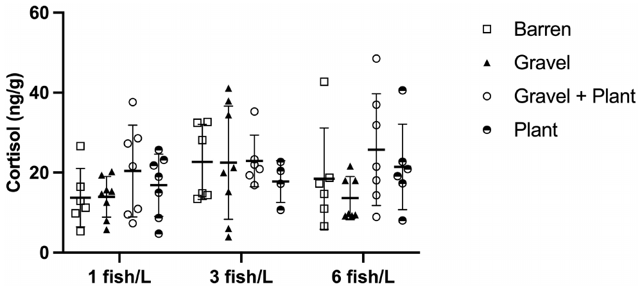
An individual challenge can erase a group difference
Individual secretion ranged from 3.9 to 72.4 ng/g/h, but the tested density and enrichment comparisons did not yield clear differences. Housing-associated endocrine differences were therefore detectable in group confinement without appearing equivalently in isolated individual confinement.
The researchers also confined individual zebrafish in 50 mL tubes for 30 minutes and measured waterborne cortisol. The endocrine readout was normalized to fish mass and time, yielding ng/g/h. This challenge separated each animal from the social setting present during the group test.
The tube challenge combined restricted movement with separation from companions. The group challenge instead preserved social contact under shallow-water confinement. These different demands explain why a housing association can appear in one endocrine assay while another yields similar values, making the challenge itself part of the biological context.
Sen Sarma et al. (2023), Fig. 4. Cortisol release after individual confinement.
Sen Sarma et al. (2023)
28
Notes:
• Individual secretion ranged from 3.9 to 72.4 ng/g/h, but the tested density and enrichment comparisons did not yield clear differences. Housing-associated endocrine differences were therefore detectable in group confinement without appearing equivalently in isolated individual confinement.
• The researchers also confined individual zebrafish in 50 mL tubes for 30 minutes and measured waterborne cortisol. The endocrine readout was normalized to fish mass and time, yielding ng/g/h. This challenge separated each animal from the social setting present during the group test.
• The tube challenge combined restricted movement with separation from companions. The group challenge instead preserved social contact under shallow-water confinement. These different demands explain why a housing association can appear in one endocrine assay while another yields similar values, making the challenge itself part of the biological context.
• The individual comparisons covered selected housing contrasts rather than every group in the broader rearing experiment. Normalization by body mass also differs from the per-fish normalization of the group challenge. The relevant conclusion is assay dependence, not that a fish’s prior housing has no physiological consequences.
References:
Sen Sarma O, Frymus N, Axling F, Thörnqvist PO, Roman E, Winberg S (2023). Optimizing zebrafish rearing−Effects of fish density and environmental enrichment. Frontiers in Behavioral Neuroscience 17: 1204021. https://doi.org/10.3389/fnbeh.2023.1204021
Figure: Sen Sarma et al. (2023), Fig. 4. Cortisol release after individual confinement.
Figure source: https://doi.org/10.3389/fnbeh.2023.1204021

Slide 29
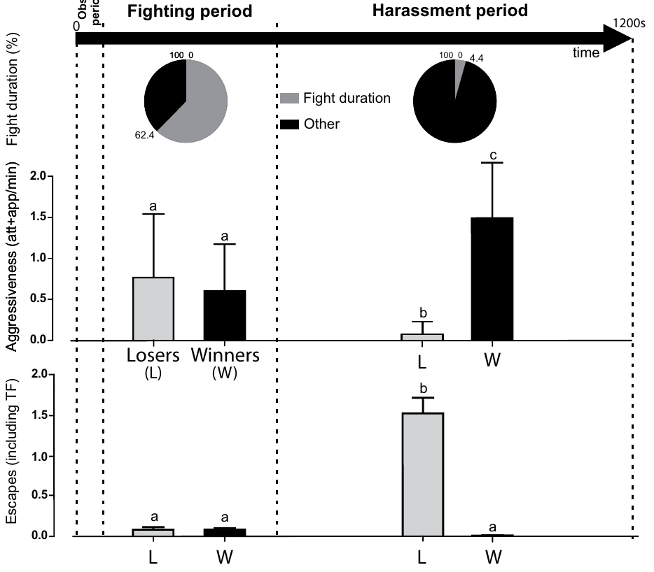
Confinement prolongs aggression after crayfish defeat
Bacqué-Cazenave and colleagues paired previously isolated, size-matched male crayfish in a confined arena for 20 minutes. Encounters progressed from exploration to fighting, then to continued attacks after one animal retreated. Social defeat refers here to the outcome of this observed contest rather than an inferred subjective report.
After defeat, the loser largely stopped fighting while the winner continued approaches and attacks. The loser responded with escapes. The prolonged post-defeat phase differed from mutual fighting, because one animal repeatedly attempted to withdraw while remaining within its opponent’s reach.
After withdrawal, the loser’s behavior shifted toward escape while the winner continued pursuit. The 33 × 23 × 20 cm arena kept the animals within repeated contact. Confinement therefore sustained an asymmetric interaction after the initial contest had ended, linking available separation distance to the sequence of attacks and escapes.
Bacqué-Cazenave et al. (2017), Fig. 1. Fighting, harassment and escape after pairing.
Bacqué-Cazenave et al. (2017)
29
Notes:
• Bacqué-Cazenave and colleagues paired previously isolated, size-matched male crayfish in a confined arena for 20 minutes. Encounters progressed from exploration to fighting, then to continued attacks after one animal retreated. Social defeat refers here to the outcome of this observed contest rather than an inferred subjective report.
• After defeat, the loser largely stopped fighting while the winner continued approaches and attacks. The loser responded with escapes. The prolonged post-defeat phase differed from mutual fighting, because one animal repeatedly attempted to withdraw while remaining within its opponent’s reach.
• After withdrawal, the loser’s behavior shifted toward escape while the winner continued pursuit. The 33 × 23 × 20 cm arena kept the animals within repeated contact. Confinement therefore sustained an asymmetric interaction after the initial contest had ended, linking available separation distance to the sequence of attacks and escapes.
• The paper’s arena measured 33 × 23 × 20 cm. Animals had been isolated for at least two to three weeks before pairing, so the experiment concerns a particular territorial and social history. The authors’ stronger language about psychological harassment should be distinguished from the observed asymmetry in attacks and retreat.
References:
Bacqué-Cazenave J, Cattaert D, Delbecque JP, Fossat P (2017). Social harassment induces anxiety-like behaviour in crayfish. Scientific Reports 7: 39935. https://doi.org/10.1038/srep39935
Figure: Bacqué-Cazenave et al. (2017), Fig. 1. Fighting, harassment and escape after pairing.
Figure source: https://doi.org/10.1038/srep39935

Slide 30
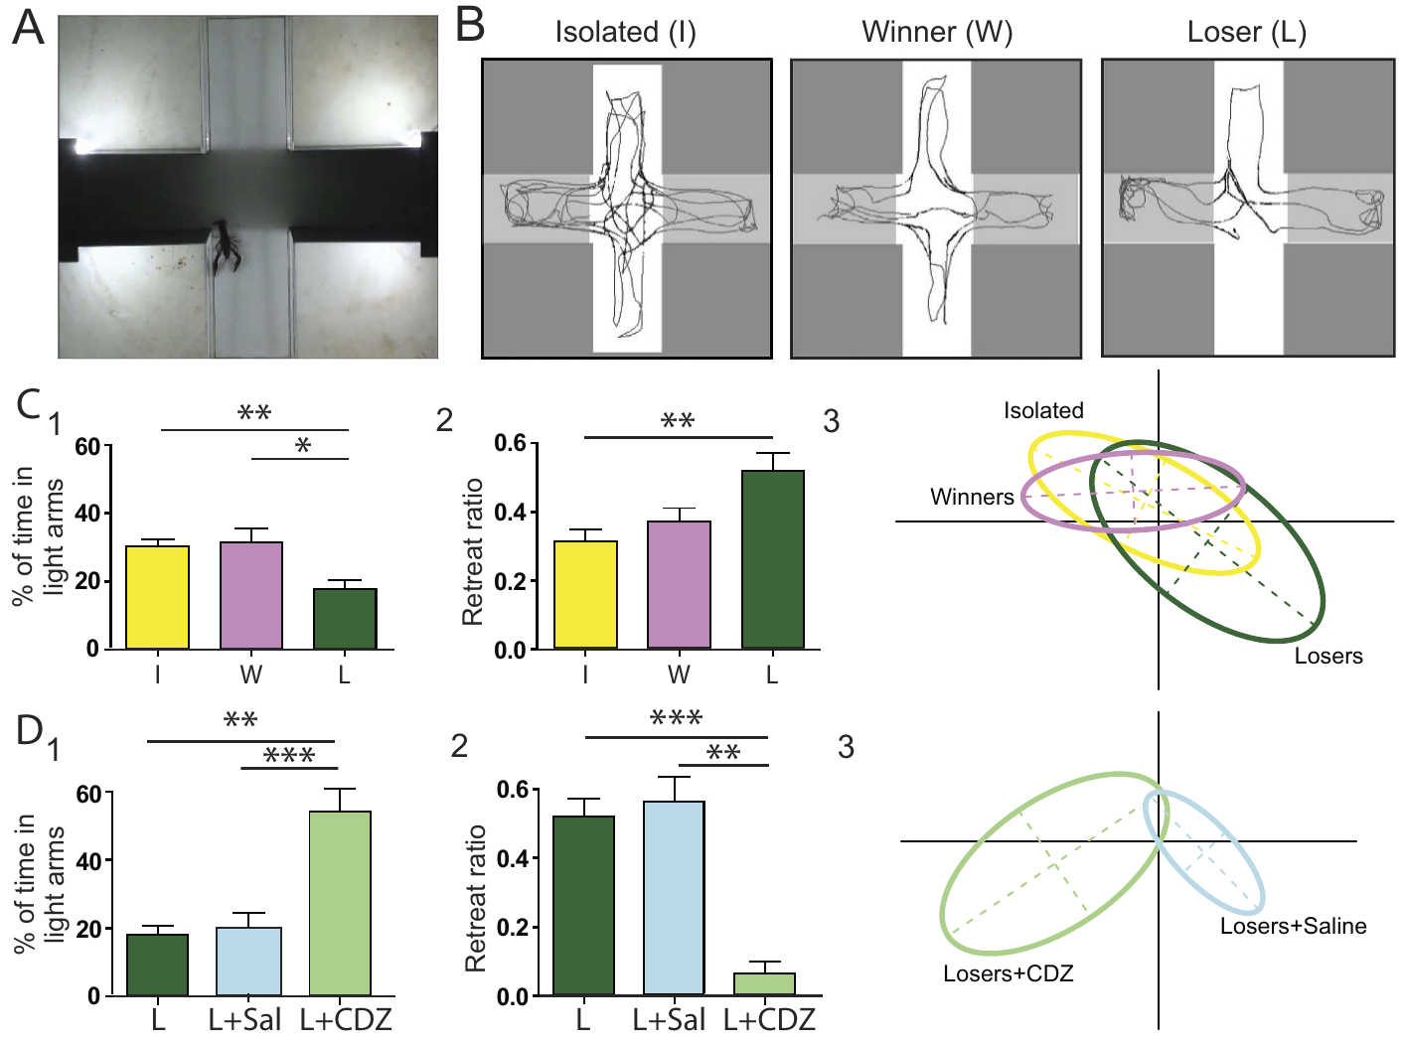
Defeated crayfish avoid illuminated spaces
Losers spent about 18% of their time in illuminated arms, compared with about 30% for winners and 32% for isolated controls. The drug chlordiazepoxide increased light-arm exploration in defeated animals, with saline injections controlling for the administration procedure.
After pairing, crayfish explored a plus maze containing dark and illuminated arms. Anxiety-like behavior was operationalized as stronger light avoidance and more retreats at dark–light boundaries. Winners and previously isolated animals provided comparisons for the defeated animals.
The defensive response persisted into a separate maze after the contest. Dark–light boundaries elicited retreats, and reduced occupation of illuminated arms supplied a second measure of avoidance. Pharmacological sensitivity connected this post-encounter pattern to a modifiable behavioral state rather than only to movements made during fighting.
Bacqué-Cazenave et al. (2017), Fig. 2(A–D). Light avoidance after defeat and chlordiazepoxide treatment.
Bacqué-Cazenave et al. (2017)
30
Notes:
• Losers spent about 18% of their time in illuminated arms, compared with about 30% for winners and 32% for isolated controls. The drug chlordiazepoxide increased light-arm exploration in defeated animals, with saline injections controlling for the administration procedure.
• After pairing, crayfish explored a plus maze containing dark and illuminated arms. Anxiety-like behavior was operationalized as stronger light avoidance and more retreats at dark–light boundaries. Winners and previously isolated animals provided comparisons for the defeated animals.
• The defensive response persisted into a separate maze after the contest. Dark–light boundaries elicited retreats, and reduced occupation of illuminated arms supplied a second measure of avoidance. Pharmacological sensitivity connected this post-encounter pattern to a modifiable behavioral state rather than only to movements made during fighting.
• The assay recorded several movement-related variables in addition to light-arm occupancy. Chlordiazepoxide is an anxiolytic compound in vertebrate clinical use, but a similar behavioral effect across taxa does not prove identical receptors or identical feelings. The controls are most informative about the operational defensive behavior measured here.
References:
Bacqué-Cazenave J, Cattaert D, Delbecque JP, Fossat P (2017). Social harassment induces anxiety-like behaviour in crayfish. Scientific Reports 7: 39935. https://doi.org/10.1038/srep39935
Figure: Bacqué-Cazenave et al. (2017), Fig. 2(A–D). Light avoidance after defeat and chlordiazepoxide treatment.
Figure source: https://doi.org/10.1038/srep39935

Slide 31
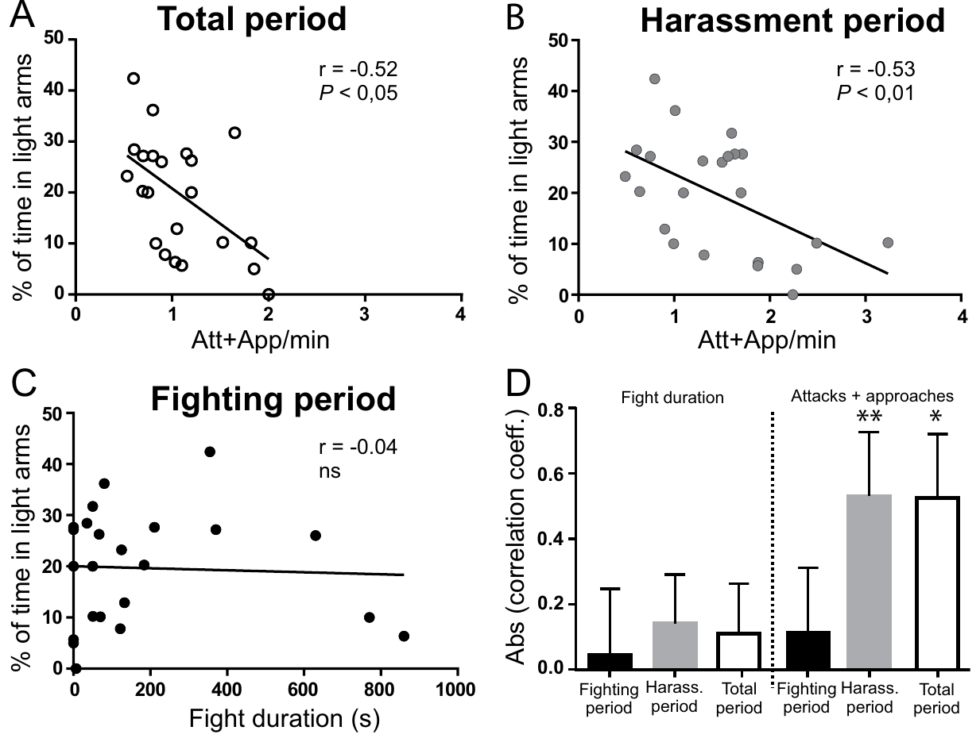
Post-defeat attacks predict later avoidance
More attacks during the post-defeat harassment phase were associated with less subsequent light-arm exploration. Duration of fighting did not show the same relationship. Thus, the measured consequence was more closely associated with what happened after withdrawal than with time spent in the initial contest.
The pairing observations allowed attacks before and after defeat to be separated. Investigators related the winner’s approaches and attacks to the loser’s later time in illuminated maze arms. This comparison tested whether sustained hostile contact, rather than fighting duration alone, tracked the defensive state.
Defeat separated two phases with different interaction patterns: reciprocal fighting and pursuit of an animal attempting to withdraw. Post-defeat attacks tracked later avoidance more closely than the duration of mutual fighting. Recording the sequence identifies continued exposure after retreat as a distinct biological event within the encounter.
Bacqué-Cazenave et al. (2017), Fig. 3(A–D). Harassment intensity and subsequent light avoidance.
Bacqué-Cazenave et al. (2017)
31
Notes:
• More attacks during the post-defeat harassment phase were associated with less subsequent light-arm exploration. Duration of fighting did not show the same relationship. Thus, the measured consequence was more closely associated with what happened after withdrawal than with time spent in the initial contest.
• The pairing observations allowed attacks before and after defeat to be separated. Investigators related the winner’s approaches and attacks to the loser’s later time in illuminated maze arms. This comparison tested whether sustained hostile contact, rather than fighting duration alone, tracked the defensive state.
• Defeat separated two phases with different interaction patterns: reciprocal fighting and pursuit of an animal attempting to withdraw. Post-defeat attacks tracked later avoidance more closely than the duration of mutual fighting. Recording the sequence identifies continued exposure after retreat as a distinct biological event within the encounter.
• The timing of behavior matters because defeat is a transition in the interaction: the loser ceases reciprocal aggression while the winner may continue. A correlation with later avoidance narrows the candidate exposure without proving that the attacks alone caused every observed change. The aquarium design constrained separation throughout the encounter.
References:
Bacqué-Cazenave J, Cattaert D, Delbecque JP, Fossat P (2017). Social harassment induces anxiety-like behaviour in crayfish. Scientific Reports 7: 39935. https://doi.org/10.1038/srep39935
Figure: Bacqué-Cazenave et al. (2017), Fig. 3(A–D). Harassment intensity and subsequent light avoidance.
Figure source: https://doi.org/10.1038/srep39935

Slide 32
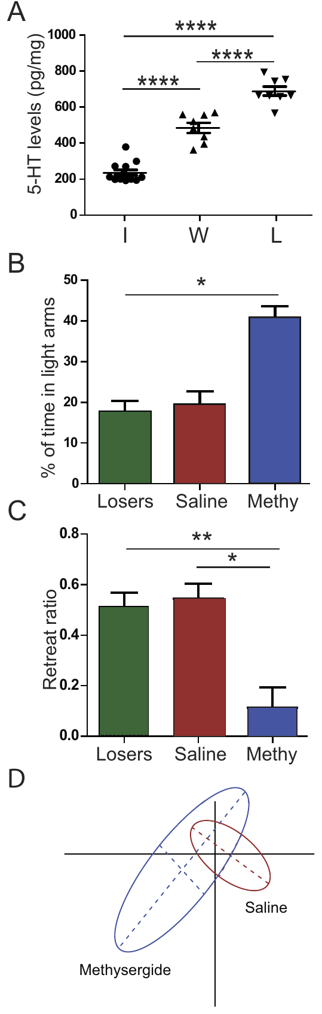
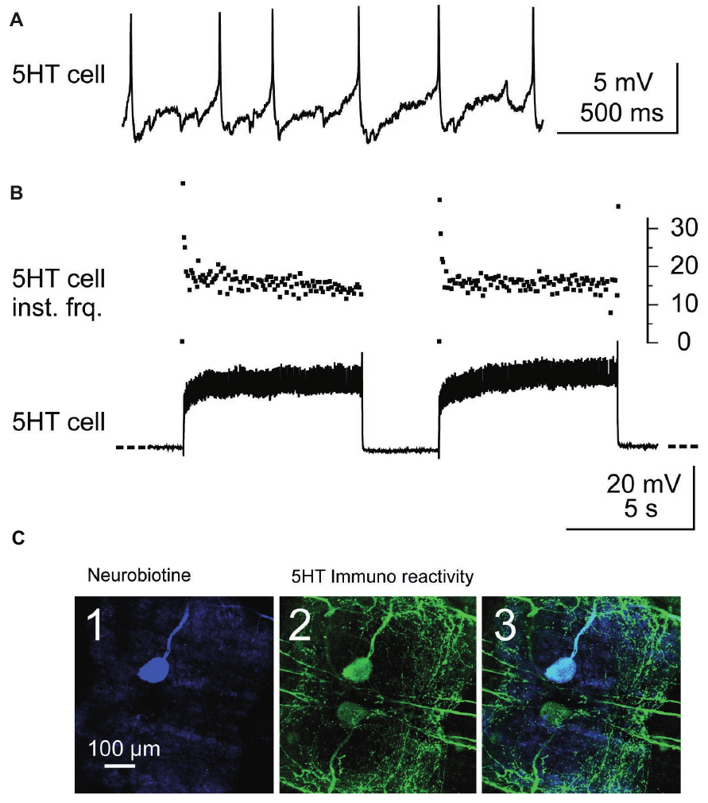
Serotonin contributes to the post-defeat state
Serotonin, also called 5-hydroxytryptamine or 5-HT, is a transmitter that modulates neural circuits. Brain serotonin was measured after the 20-minute pairing. Concentrations averaged about 236 pg/mg in isolated crayfish, 486 pg/mg in winners, and 691 pg/mg in losers.
Before pairing, methysergide, a broad serotonin-receptor antagonist, was given to the animal expected to lose. Compared with saline controls, treated defeated animals explored illuminated arms more and retreated less. They still lost the contest, separating the defensive state from the act of retreating during defeat.
A receptor antagonist reduces signaling through the receptors it targets. Methysergide altered later light avoidance despite preserving the loss of the contest. Serotonin-receptor signaling therefore contributed to the post-defeat defensive response, separating modulation of the later behavioral state from the contest outcome itself.
Bacqué-Cazenave et al. (2019), Fig. 2(A–C). Serotonergic neuron activity and identification.
Bacqué-Cazenave et al. (2017), Fig. 4(A–D). Brain serotonin and methysergide effects after defeat.
Bacqué-Cazenave et al. (2017); Bacqué-Cazenave et al. (2019)
32
Notes:
• Serotonin, also called 5-hydroxytryptamine or 5-HT, is a transmitter that modulates neural circuits. Brain serotonin was measured after the 20-minute pairing. Concentrations averaged about 236 pg/mg in isolated crayfish, 486 pg/mg in winners, and 691 pg/mg in losers.
• Before pairing, methysergide, a broad serotonin-receptor antagonist, was given to the animal expected to lose. Compared with saline controls, treated defeated animals explored illuminated arms more and retreated less. They still lost the contest, separating the defensive state from the act of retreating during defeat.
• A receptor antagonist reduces signaling through the receptors it targets. Methysergide altered later light avoidance despite preserving the loss of the contest. Serotonin-receptor signaling therefore contributed to the post-defeat defensive response, separating modulation of the later behavioral state from the contest outcome itself.
• Brain serotonin was measured in tissue, whereas the receptor intervention tested behavior after defeat. The separate motor-circuit anatomy identifies a serotonergic cell but concerns proprioceptive modulation. These studies address different functions of serotonin, with a receptor-dependent defensive response and mixed effects on postural motor neurons.
References:
Bacqué-Cazenave J, Cattaert D, Delbecque JP, Fossat P (2017). Social harassment induces anxiety-like behaviour in crayfish. Scientific Reports 7: 39935. https://doi.org/10.1038/srep39935
Bacqué-Cazenave J, Fossat P, Issa FA, Edwards DH, Delbecque JP, Cattaert D (2019). Duality of 5-HT Effects on Crayfish Motoneurons. Frontiers in Physiology 10: 1280. https://doi.org/10.3389/fphys.2019.01280
Figure: Bacqué-Cazenave et al. (2017), Fig. 4(A–D). Brain serotonin and methysergide effects after defeat.
Figure source: https://doi.org/10.1038/srep39935
Figure: Bacqué-Cazenave et al. (2019), Fig. 2(A–C). Serotonergic neuron activity and identification.
Figure source: https://doi.org/10.3389/fphys.2019.01280

Slide 33
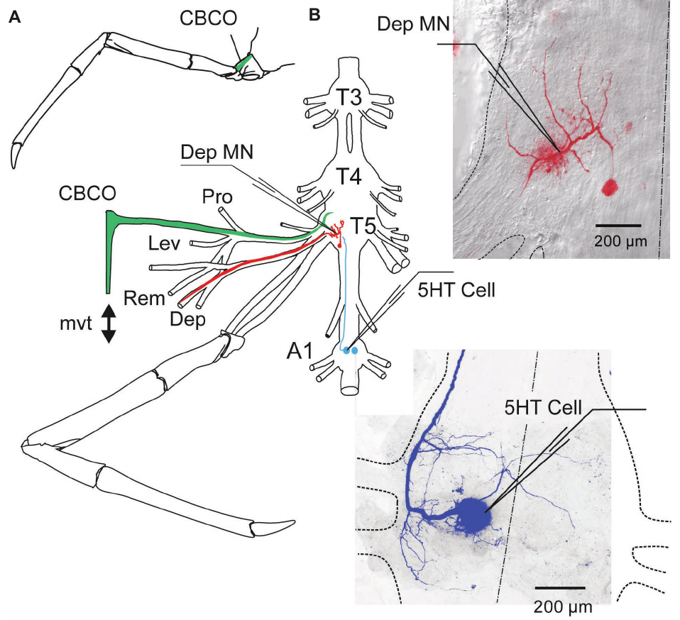
A single serotonin cell modulates a motor network
In a separate crayfish study, researchers stimulated an identified serotonergic neuron in the first abdominal ganglion while recording walking-leg motor output. A ganglion is a cluster of neuronal cell bodies. Immunostaining and intracellular labeling confirmed that the recorded cell contained serotonin.
Current pulses drove the cell to fire initially at up to 40 Hz, then adapt toward about 17 Hz. Motor neurons in the connected postural network increased, decreased, or maintained their activity during this stimulation. Serotonin therefore did not impose a single uniform direction of motor response.
The retained coxo-basipodite chordotonal organ detected movement near the base of a walking leg. Stretching its sensory strand supplied position-related input to the central network. Stimulating an identified serotonergic cell while recording this network connected transmitter-neuron firing to the regulation of a specific postural response.
Bacqué-Cazenave et al. (2019), Fig. 2(A–C). Serotonergic neuron activity and identification.
Bacqué-Cazenave et al. (2019), Fig. 1(A,B). Walking-leg sensory and motor anatomy.
Bacqué-Cazenave et al. (2019)
33
Notes:
• In a separate crayfish study, researchers stimulated an identified serotonergic neuron in the first abdominal ganglion while recording walking-leg motor output. A ganglion is a cluster of neuronal cell bodies. Immunostaining and intracellular labeling confirmed that the recorded cell contained serotonin.
• Current pulses drove the cell to fire initially at up to 40 Hz, then adapt toward about 17 Hz. Motor neurons in the connected postural network increased, decreased, or maintained their activity during this stimulation. Serotonin therefore did not impose a single uniform direction of motor response.
• The retained coxo-basipodite chordotonal organ detected movement near the base of a walking leg. Stretching its sensory strand supplied position-related input to the central network. Stimulating an identified serotonergic cell while recording this network connected transmitter-neuron firing to the regulation of a specific postural response.
• The coxo-basipodite chordotonal organ detects movement at a joint near the base of the walking leg. Stretching its strand reproduced sensory input while the experimenter recorded motor neurons that influence leg position. The cellular identification distinguishes stimulation of an actual serotonergic neuron from simply adding serotonin to the bath.
References:
Bacqué-Cazenave J, Fossat P, Issa FA, Edwards DH, Delbecque JP, Cattaert D (2019). Duality of 5-HT Effects on Crayfish Motoneurons. Frontiers in Physiology 10: 1280. https://doi.org/10.3389/fphys.2019.01280
Figure: Bacqué-Cazenave et al. (2019), Fig. 2(A–C). Serotonergic neuron activity and identification.
Figure source: https://doi.org/10.3389/fphys.2019.01280
Figure: Bacqué-Cazenave et al. (2019), Fig. 1(A,B). Walking-leg sensory and motor anatomy.
Figure source: https://doi.org/10.3389/fphys.2019.01280

Slide 34
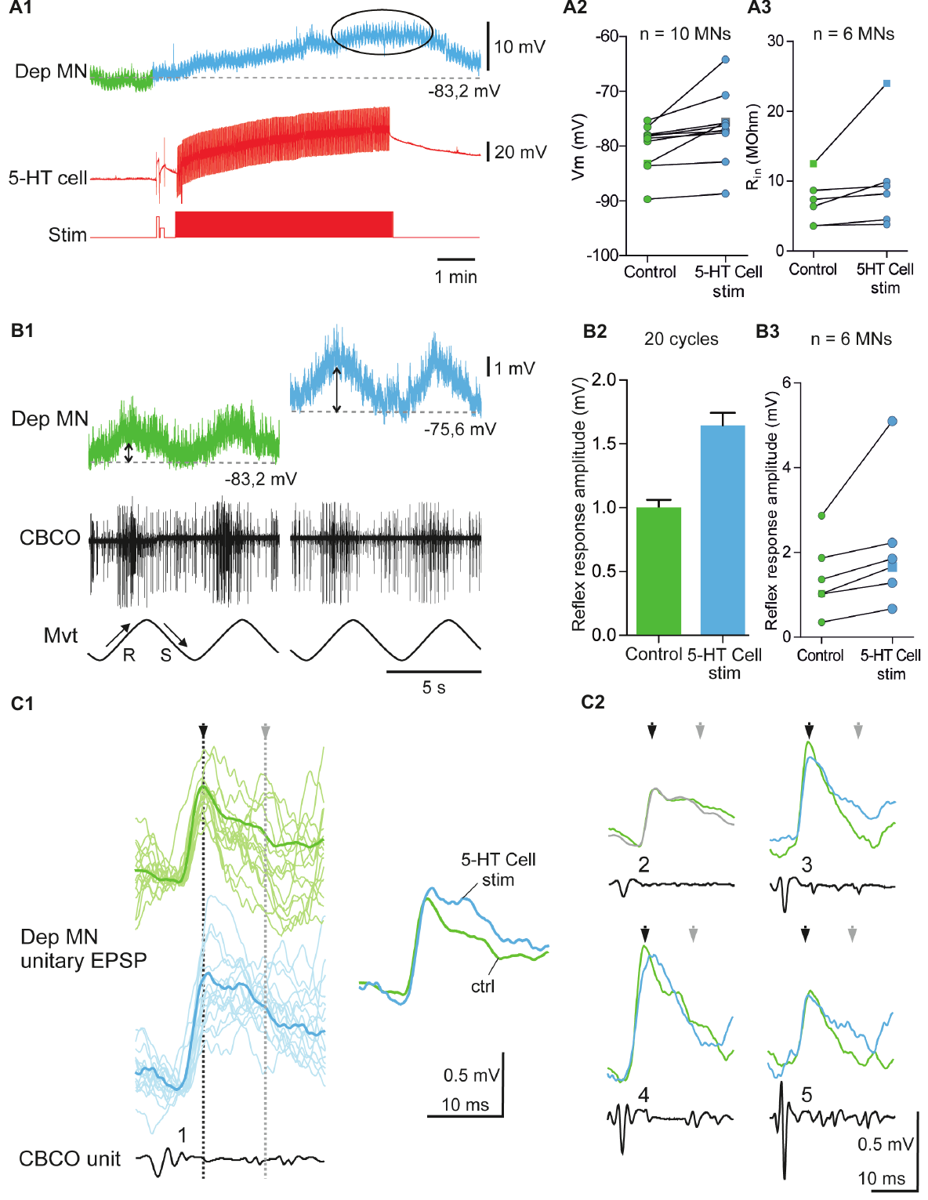
Serotonin can amplify sensory-driven motor responses
A motor neuron carries neural output toward muscle, while an excitatory postsynaptic potential is a depolarizing response to synaptic input. In some depressor motor neurons, stimulation of the serotonergic cell depolarized the membrane and increased input resistance. The depressor network contributes to downward leg movement.
In the published example, membrane voltage changed from −83.2 to −75.6 mV, and the sensory-driven response increased from about 0.99 to 1.64 mV. Responses to movement of the retained proprioceptor were measured before and during serotonergic-cell stimulation in the same preparation.
Greater input resistance produces a larger voltage response to a given synaptic current. Depolarization also places the membrane closer to spike threshold, and slower decay prolongs the sensory input’s influence. These changes acted together in the excited cells, amplifying the pathway from proprioceptor activity to depressor motor output.
Bacqué-Cazenave et al. (2019), Fig. 2(A–C). Serotonergic neuron activity and identification.
Bacqué-Cazenave et al. (2019), Fig. 4(A–C). Depolarization, input resistance and sensory responses.
Bacqué-Cazenave et al. (2019)
34
Notes:
• A motor neuron carries neural output toward muscle, while an excitatory postsynaptic potential is a depolarizing response to synaptic input. In some depressor motor neurons, stimulation of the serotonergic cell depolarized the membrane and increased input resistance. The depressor network contributes to downward leg movement.
• In the published example, membrane voltage changed from −83.2 to −75.6 mV, and the sensory-driven response increased from about 0.99 to 1.64 mV. Responses to movement of the retained proprioceptor were measured before and during serotonergic-cell stimulation in the same preparation.
• Greater input resistance produces a larger voltage response to a given synaptic current. Depolarization also places the membrane closer to spike threshold, and slower decay prolongs the sensory input’s influence. These changes acted together in the excited cells, amplifying the pathway from proprioceptor activity to depressor motor output.
• The resting voltage shift makes the neuron less negative, while increased input resistance permits a given synaptic current to produce a larger voltage change. The authors also observed a slower late decay of some excitatory potentials. These are measured physiological contributions, distinct from a claim about an animal’s emotional state.
References:
Bacqué-Cazenave J, Fossat P, Issa FA, Edwards DH, Delbecque JP, Cattaert D (2019). Duality of 5-HT Effects on Crayfish Motoneurons. Frontiers in Physiology 10: 1280. https://doi.org/10.3389/fphys.2019.01280
Figure: Bacqué-Cazenave et al. (2019), Fig. 4(A–C). Depolarization, input resistance and sensory responses.
Figure source: https://doi.org/10.3389/fphys.2019.01280
Figure: Bacqué-Cazenave et al. (2019), Fig. 2(A–C). Serotonergic neuron activity and identification.
Figure source: https://doi.org/10.3389/fphys.2019.01280

Slide 35
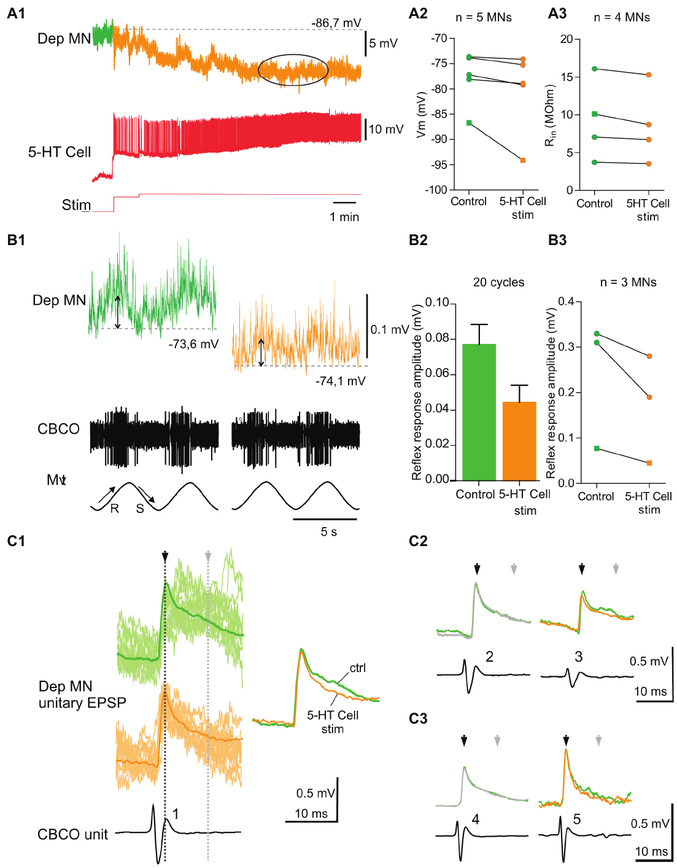
The same serotonin input can suppress other neurons
Other depressor motor neurons responded to the same identified serotonin-cell stimulation with hyperpolarization, a shift to more negative voltage, and reduced input resistance. Sensory-driven responses became smaller rather than larger. These opposing effects occurred within the tested motor system.
In one recorded example, the reflex-related voltage response declined from about 0.077 to 0.045 mV. Synaptic potentials also decayed faster. Reduced voltage responsiveness and a more negative baseline can jointly decrease the influence of a sensory input on the cell’s motor output.
A more negative membrane voltage moves the cell farther from spike threshold, while lower resistance reduces the voltage response to input. Faster synaptic decay shortens its influence. The authors’ hypothesis links the opposing motor-neuron responses to differences in receptor location and local serotonin signaling within the same postural network.
Bacqué-Cazenave et al. (2019), Fig. 2(A–C). Serotonergic neuron activity and identification.
Bacqué-Cazenave et al. (2019), Fig. 5(A–C). Hyperpolarization and reduced sensory responses.
Bacqué-Cazenave et al. (2019)
35
Notes:
• Other depressor motor neurons responded to the same identified serotonin-cell stimulation with hyperpolarization, a shift to more negative voltage, and reduced input resistance. Sensory-driven responses became smaller rather than larger. These opposing effects occurred within the tested motor system.
• In one recorded example, the reflex-related voltage response declined from about 0.077 to 0.045 mV. Synaptic potentials also decayed faster. Reduced voltage responsiveness and a more negative baseline can jointly decrease the influence of a sensory input on the cell’s motor output.
• A more negative membrane voltage moves the cell farther from spike threshold, while lower resistance reduces the voltage response to input. Faster synaptic decay shortens its influence. The authors’ hypothesis links the opposing motor-neuron responses to differences in receptor location and local serotonin signaling within the same postural network.
• The excitatory and inhibitory examples came from the same kind of preparation, with animals isolated before experiments. Consequently, the observed diversity could not simply be assigned to the winner–loser comparison in the separate social study. Differences in cellular signaling must be considered before inferring behavior from a transmitter measurement.
References:
Bacqué-Cazenave J, Fossat P, Issa FA, Edwards DH, Delbecque JP, Cattaert D (2019). Duality of 5-HT Effects on Crayfish Motoneurons. Frontiers in Physiology 10: 1280. https://doi.org/10.3389/fphys.2019.01280
Figure: Bacqué-Cazenave et al. (2019), Fig. 5(A–C). Hyperpolarization and reduced sensory responses.
Figure source: https://doi.org/10.3389/fphys.2019.01280
Figure: Bacqué-Cazenave et al. (2019), Fig. 2(A–C). Serotonergic neuron activity and identification.
Figure source: https://doi.org/10.3389/fphys.2019.01280

Slide 36
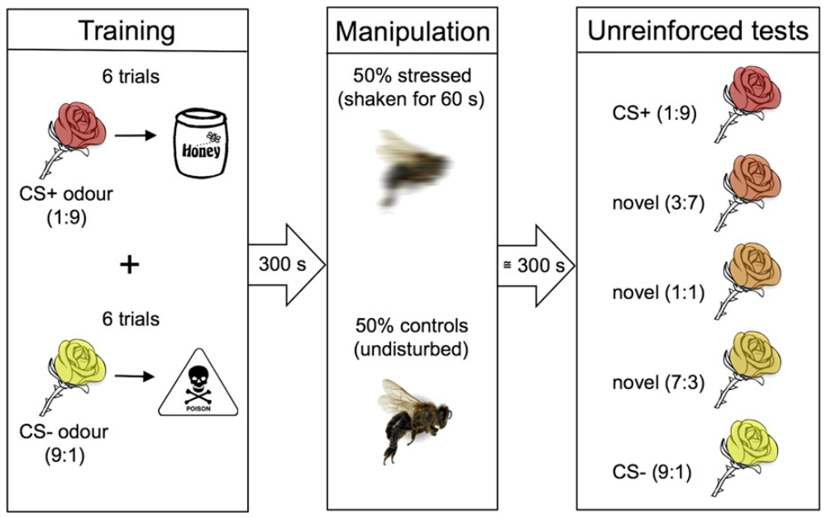
Bees learn different outcomes for odor mixtures
Bateson and colleagues trained honeybees to distinguish two mixtures of 1-hexanol and 2-octanone. One mixture predicted sucrose; the other predicted a less favorable outcome such as quinine. Proboscis extension, extending the feeding mouthparts, served as the measured response rather than locomotor approach.
The rewarded and negative cues used opposite 1:9 and 9:1 mixtures, with three intermediate mixtures presented without reinforcement during testing. These ambiguous odors tested generalization between learned outcomes. After training, experimental bees were shaken for 60 seconds while controls remained undisturbed.
Training assigned different outcomes to mixtures of the same two odorants before disturbance occurred. The intermediate mixtures then tested how the learned classification extended between those outcomes. Shaking changed the animal’s state after acquisition, allowing the test to measure altered responses to previously learned and ambiguous sensory cues.
Bateson et al. (2011), Fig. 1. Odor conditioning, shaking and ambiguous test stimuli.
Bateson et al. (2011)
36
Notes:
• Bateson and colleagues trained honeybees to distinguish two mixtures of 1-hexanol and 2-octanone. One mixture predicted sucrose; the other predicted a less favorable outcome such as quinine. Proboscis extension, extending the feeding mouthparts, served as the measured response rather than locomotor approach.
• The rewarded and negative cues used opposite 1:9 and 9:1 mixtures, with three intermediate mixtures presented without reinforcement during testing. These ambiguous odors tested generalization between learned outcomes. After training, experimental bees were shaken for 60 seconds while controls remained undisturbed.
• Training assigned different outcomes to mixtures of the same two odorants before disturbance occurred. The intermediate mixtures then tested how the learned classification extended between those outcomes. Shaking changed the animal’s state after acquisition, allowing the test to measure altered responses to previously learned and ambiguous sensory cues.
• The paper tested more than one combination of favorable and unfavorable outcomes, rather than relying on a single punishment procedure. The intermediate odors varied the same chemical mixture used during training. Their ambiguous status refers to their position between learned cues, not to a claim that their sensory properties were unknown.
References:
Bateson M, Desire S, Gartside SE, Wright GA (2011). Agitated Honeybees Exhibit Pessimistic Cognitive Biases. Current Biology 21: 1070-1073. https://doi.org/10.1016/j.cub.2011.05.017
Figure: Bateson et al. (2011), Fig. 1. Odor conditioning, shaking and ambiguous test stimuli.
Figure source: https://doi.org/10.1016/j.cub.2011.05.017

Slide 37
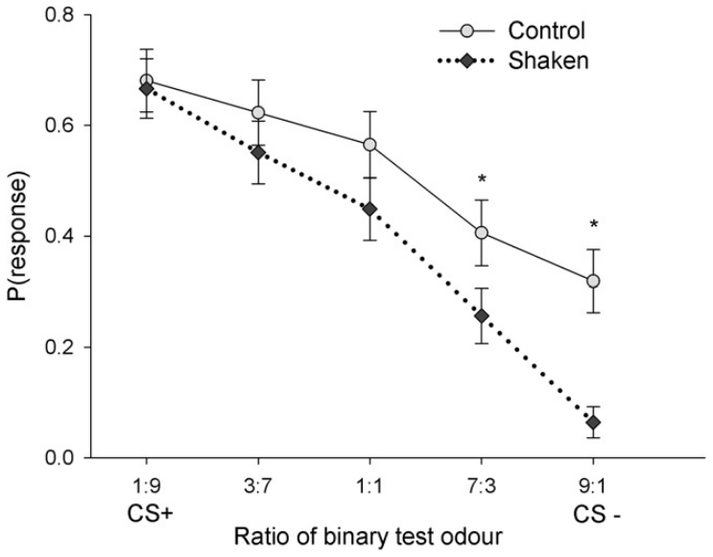
Acute disturbance biases responses to ambiguous odors
A judgment bias is a change in how an animal responds to an uncertain cue associated with possible favorable or unfavorable outcomes. Following 60 seconds of shaking, bees were tested within 5 minutes using the trained odors and three intermediate mixtures.
Shaken bees were less likely to extend the proboscis to the negative cue and the intermediate odor nearest it. Responses to the rewarded cue were not detectably reduced. The selective pattern limits an explanation based only on a general inability or unwillingness to extend the feeding mouthparts.
The effect was strongest near the negative end of the trained odor continuum, while the rewarded cue retained its response. A general failure to extend the proboscis would have affected that positive response as well. The authors’ hypothesis is that acute disturbance shifted the bees’ expectations toward unfavorable outcomes under ambiguity.
Bateson et al. (2011), Fig. 3. Proboscis responses to trained and ambiguous odors.
Bateson et al. (2011)
37
Notes:
• A judgment bias is a change in how an animal responds to an uncertain cue associated with possible favorable or unfavorable outcomes. Following 60 seconds of shaking, bees were tested within 5 minutes using the trained odors and three intermediate mixtures.
• Shaken bees were less likely to extend the proboscis to the negative cue and the intermediate odor nearest it. Responses to the rewarded cue were not detectably reduced. The selective pattern limits an explanation based only on a general inability or unwillingness to extend the feeding mouthparts.
• The effect was strongest near the negative end of the trained odor continuum, while the rewarded cue retained its response. A general failure to extend the proboscis would have affected that positive response as well. The authors’ hypothesis is that acute disturbance shifted the bees’ expectations toward unfavorable outcomes under ambiguity.
• A preserved response to the positive cue is a useful control for broad sensory or motor suppression, although it cannot exclude every possible perceptual effect. The original study found the strongest effect near the negative cue. The inference concerns a bias in learned classification after acute disturbance, not a measurement of chronic hive conditions.
References:
Bateson M, Desire S, Gartside SE, Wright GA (2011). Agitated Honeybees Exhibit Pessimistic Cognitive Biases. Current Biology 21: 1070-1073. https://doi.org/10.1016/j.cub.2011.05.017
Figure: Bateson et al. (2011), Fig. 3. Proboscis responses to trained and ambiguous odors.
Figure source: https://doi.org/10.1016/j.cub.2011.05.017

Slide 38
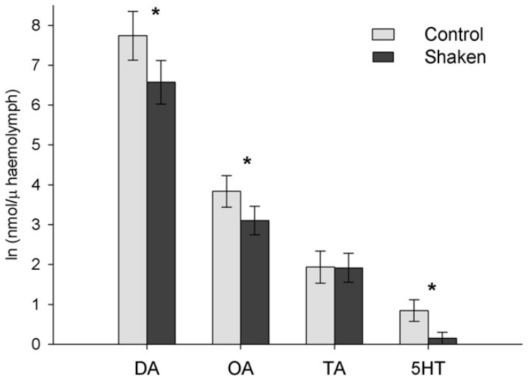
Bee monoamine changes are not circuit measurements
In a separate group of bees, researchers measured hemolymph, the circulating fluid of insects, after the same shaking treatment. Dopamine, octopamine, serotonin, and tyramine were assayed. Octopamine is a signaling molecule with important roles in insect modulation and reward-related learning.
Around 300 seconds after shaking, dopamine, octopamine, and serotonin concentrations were reduced, whereas tyramine did not show the same clear reduction. The sampling time matched the period when the behavioral tests were performed. These physiological changes accompanied the treatment that altered judgment.
Monoamines are a class of signaling molecules that includes dopamine, serotonin and octopamine. Hemolymph sampling captured their circulating concentrations during the behavioral test interval. The treatment changed several modulators together, connecting a brief disturbance with a physiological state extending beyond the immediate shaking event.
Bateson et al. (2011), Fig. 2. Hemolymph monoamines after shaking.
Bateson et al. (2011), Fig. 1. Odor conditioning, shaking and ambiguous test stimuli.
Bateson et al. (2011)
38
Notes:
• In a separate group of bees, researchers measured hemolymph, the circulating fluid of insects, after the same shaking treatment. Dopamine, octopamine, serotonin, and tyramine were assayed. Octopamine is a signaling molecule with important roles in insect modulation and reward-related learning.
• Around 300 seconds after shaking, dopamine, octopamine, and serotonin concentrations were reduced, whereas tyramine did not show the same clear reduction. The sampling time matched the period when the behavioral tests were performed. These physiological changes accompanied the treatment that altered judgment.
• Monoamines are a class of signaling molecules that includes dopamine, serotonin and octopamine. Hemolymph sampling captured their circulating concentrations during the behavioral test interval. The treatment changed several modulators together, connecting a brief disturbance with a physiological state extending beyond the immediate shaking event.
• Physiology and behavior were measured in different groups, so their association is at the treatment level rather than an individual-by-individual correlation. Monoamines can act as circulating modulators as well as local transmitters in insects. Neither role permits inferring a synaptic concentration directly from a hemolymph sample.
References:
Bateson M, Desire S, Gartside SE, Wright GA (2011). Agitated Honeybees Exhibit Pessimistic Cognitive Biases. Current Biology 21: 1070-1073. https://doi.org/10.1016/j.cub.2011.05.017
Figure: Bateson et al. (2011), Fig. 2. Hemolymph monoamines after shaking.
Figure source: https://doi.org/10.1016/j.cub.2011.05.017
Figure: Bateson et al. (2011), Fig. 1. Odor conditioning, shaking and ambiguous test stimuli.
Figure source: https://doi.org/10.1016/j.cub.2011.05.017

Slide 39
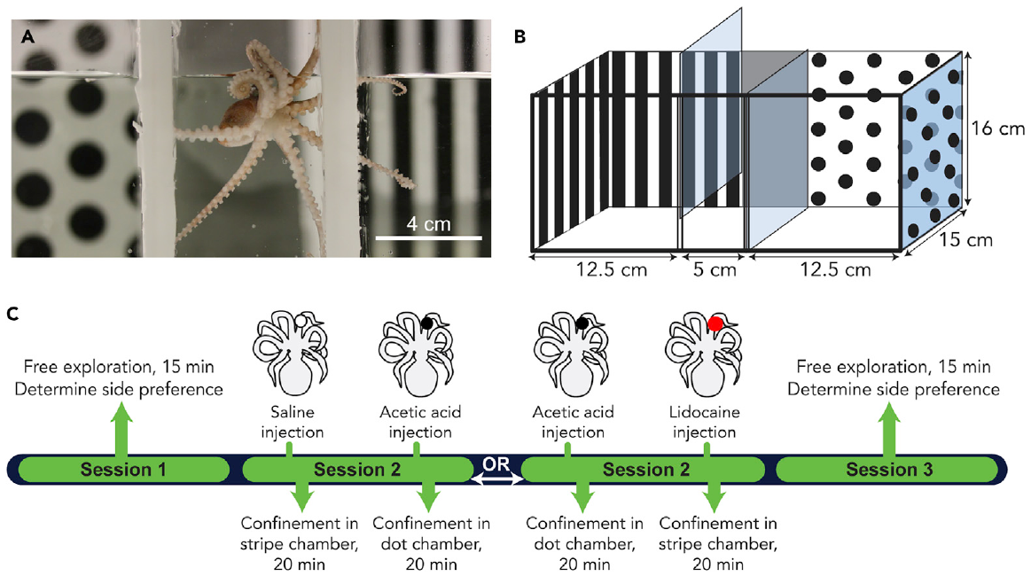
Octopuses learn places associated with injury
Crook tested Octopus bocki in chambers with distinct visual patterns. Conditioned place avoidance measures whether an animal later avoids a location associated with an adverse event. Initial preferences were assessed before conditioning, allowing later choices to be compared with each animal’s earlier behavior.
A 0.5% acetic-acid injection in an arm was paired with the initially preferred chamber; saline injection provided a procedural control. On a later free-choice test, acid-treated octopuses reduced their time in the previously preferred chamber compared with controls.
Assigning the acid-associated event to the initially preferred chamber tested whether adverse experience could reverse an existing location preference. The later reduction in occupancy persisted beyond the injection itself. Learning linked the visual context with the event’s unfavorable value, producing avoidance when the animal could choose freely.
Crook (2021), Fig. 1(A–C). Place-conditioning apparatus and experimental timing.
Crook (2021)
39
Notes:
• Crook tested Octopus bocki in chambers with distinct visual patterns. Conditioned place avoidance measures whether an animal later avoids a location associated with an adverse event. Initial preferences were assessed before conditioning, allowing later choices to be compared with each animal’s earlier behavior.
• A 0.5% acetic-acid injection in an arm was paired with the initially preferred chamber; saline injection provided a procedural control. On a later free-choice test, acid-treated octopuses reduced their time in the previously preferred chamber compared with controls.
• Assigning the acid-associated event to the initially preferred chamber tested whether adverse experience could reverse an existing location preference. The later reduction in occupancy persisted beyond the injection itself. Learning linked the visual context with the event’s unfavorable value, producing avoidance when the animal could choose freely.
• The conditioning chambers carried distinct visual patterns, and baseline testing identified each animal’s initial preference. A later reversal after acid pairing links remembered context to adverse experience. Saline injection controlled for the procedure while leaving the acid-induced injury absent.
References:
Crook RJ (2021). Behavioral and neurophysiological evidence suggests affective pain experience in octopus. iScience 24: 102229. https://doi.org/10.1016/j.isci.2021.102229
Figure: Crook (2021), Fig. 1(A–C). Place-conditioning apparatus and experimental timing.
Figure source: https://doi.org/10.1016/j.isci.2021.102229

Slide 40
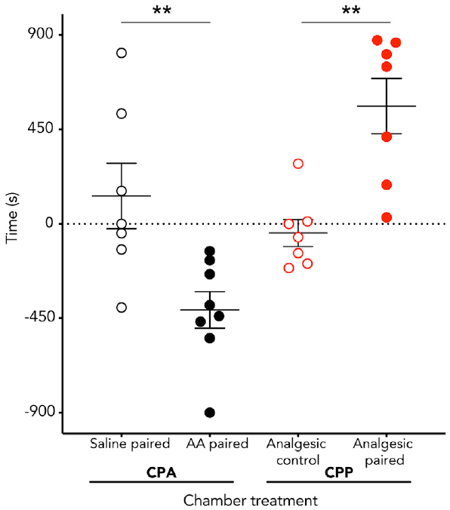
Relief is rewarding specifically after injury
Octopuses that had received acid later preferred the lidocaine-paired chamber. Animals given saline before lidocaine did not acquire the same preference. This control separates the value of relief from a claim that lidocaine is inherently rewarding regardless of the animal’s preceding state.
Conditioned place preference measures increased choice of a context associated with a favorable event. After the acid treatment, Crook paired local lidocaine treatment with the initially nonpreferred chamber. Local anesthesia reduces sensory signaling in the treated region rather than necessarily sedating the entire animal.
The saline-plus-lidocaine control preserved the anesthetic treatment while removing prior injury. Preference developed specifically when relief followed acid exposure. The favorable value of the intervention therefore depended on the preceding state, linking local sensory suppression with learned approach to the context in which relief occurred.
Crook (2021), Fig. 2. Place avoidance and preference for pain relief.
Crook (2021)
40
Notes:
• Octopuses that had received acid later preferred the lidocaine-paired chamber. Animals given saline before lidocaine did not acquire the same preference. This control separates the value of relief from a claim that lidocaine is inherently rewarding regardless of the animal’s preceding state.
• Conditioned place preference measures increased choice of a context associated with a favorable event. After the acid treatment, Crook paired local lidocaine treatment with the initially nonpreferred chamber. Local anesthesia reduces sensory signaling in the treated region rather than necessarily sedating the entire animal.
• The saline-plus-lidocaine control preserved the anesthetic treatment while removing prior injury. Preference developed specifically when relief followed acid exposure. The favorable value of the intervention therefore depended on the preceding state, linking local sensory suppression with learned approach to the context in which relief occurred.
• Affective refers to the favorable or unfavorable value of a state, whereas nociception refers to detecting potentially damaging stimulation. The relief-dependent preference tests value through learning. The saline-plus-lidocaine group is essential because a general drug preference would not specifically support relief from the injury-associated state.
References:
Crook RJ (2021). Behavioral and neurophysiological evidence suggests affective pain experience in octopus. iScience 24: 102229. https://doi.org/10.1016/j.isci.2021.102229
Figure: Crook (2021), Fig. 2. Place avoidance and preference for pain relief.
Figure source: https://doi.org/10.1016/j.isci.2021.102229

Slide 41
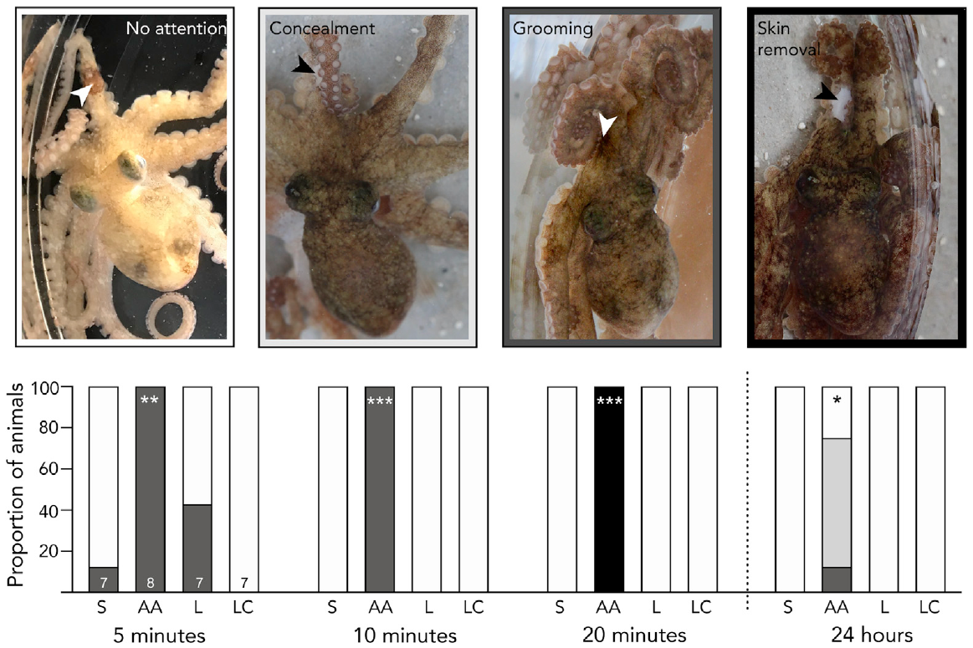
Octopus wound attention persists after the injection
Discriminative pain-related behavior is behavior directed toward the location or character of an injury. Acid-treated octopuses showed arm grooming, concealment, and skin-removal behavior localized to the injection region. Saline-treated animals did not express the same pattern.
Wound attention persisted for at least 24 hours after the acid injection. Local lidocaine suppressed the observed injury-directed grooming during treatment. The behavior therefore combined spatial specificity, persistence, and sensitivity to a locally acting intervention.
Attention remained concentrated on the injected region of one arm rather than being distributed uniformly across the body. Its persistence and suppression by local anesthesia linked injury location, ongoing sensory input and directed action. The behavioral sequence extended the evidence from learned place choice to the animal’s treatment of the affected tissue.
Crook (2021), Fig. 3. Wound-directed behavior following acetic acid.
Crook (2021)
41
Notes:
• Discriminative pain-related behavior is behavior directed toward the location or character of an injury. Acid-treated octopuses showed arm grooming, concealment, and skin-removal behavior localized to the injection region. Saline-treated animals did not express the same pattern.
• Wound attention persisted for at least 24 hours after the acid injection. Local lidocaine suppressed the observed injury-directed grooming during treatment. The behavior therefore combined spatial specificity, persistence, and sensitivity to a locally acting intervention.
• Attention remained concentrated on the injected region of one arm rather than being distributed uniformly across the body. Its persistence and suppression by local anesthesia linked injury location, ongoing sensory input and directed action. The behavioral sequence extended the evidence from learned place choice to the animal’s treatment of the affected tissue.
• Arm grooming, concealment and skin removal were localized to the treated tissue. Local anesthesia suppressed injury-directed grooming during treatment. The combined temporal and spatial pattern links the response to ongoing input from the affected region.
References:
Crook RJ (2021). Behavioral and neurophysiological evidence suggests affective pain experience in octopus. iScience 24: 102229. https://doi.org/10.1016/j.isci.2021.102229
Figure: Crook (2021), Fig. 3. Wound-directed behavior following acetic acid.
Figure source: https://doi.org/10.1016/j.isci.2021.102229

Slide 42

Arm signals remain available to the octopus brain
Nociception is neural detection and processing of potentially damaging stimulation; it is not identical to subjective pain. Crook recorded activity in the brachial connective, the nerve pathway carrying arm information toward the central brain, before and after local acid injection.
Acid treatment increased ongoing activity and responses to touch in the affected region. Local lidocaine rapidly suppressed ongoing discharge and blocked evoked activity near the injection site. The recorded pathway therefore supplied persistent injury-associated information beyond the arm’s local networks.
The brachial connective carried arm-derived activity toward the central brain. Acid increased ongoing signaling, and lidocaine suppressed both ongoing and locally evoked discharge. The same local intervention reduced wound-directed behavior, connecting persistent afferent input with actions focused on the injured arm and with the value of relief.
Crook (2021), Fig. 4(A–C). Arm afferent activity before and after local lidocaine.
Crook (2021)
42
Notes:
• Nociception is neural detection and processing of potentially damaging stimulation; it is not identical to subjective pain. Crook recorded activity in the brachial connective, the nerve pathway carrying arm information toward the central brain, before and after local acid injection.
• Acid treatment increased ongoing activity and responses to touch in the affected region. Local lidocaine rapidly suppressed ongoing discharge and blocked evoked activity near the injection site. The recorded pathway therefore supplied persistent injury-associated information beyond the arm’s local networks.
• The brachial connective carried arm-derived activity toward the central brain. Acid increased ongoing signaling, and lidocaine suppressed both ongoing and locally evoked discharge. The same local intervention reduced wound-directed behavior, connecting persistent afferent input with actions focused on the injured arm and with the value of relief.
• Stimulation at different arm positions distinguished local sensory responses from ongoing discharge. Activity in the brachial connective was recorded toward the central nervous system. Lidocaine reduced that signal while also changing injury-directed behavior and the learned value of relief.
References:
Crook RJ (2021). Behavioral and neurophysiological evidence suggests affective pain experience in octopus. iScience 24: 102229. https://doi.org/10.1016/j.isci.2021.102229
Figure: Crook (2021), Fig. 4(A–C). Arm afferent activity before and after local lidocaine.
Figure source: https://doi.org/10.1016/j.isci.2021.102229

Slide 43

Captivity reshapes cane-toad brain gene expression
Yagound and colleagues compared wild-caught cane toads with toads from the same populations maintained in captivity for 7 months. The transcriptome is the collection of expressed RNA molecules measured from tissue. Whole-brain RNA sequencing quantified expression rather than recording neuronal activity.
In long-colonized range-core populations, 951 genes differed between captive and freshly sampled toads. Expression patterns separated individuals, and functional-category analysis included behavior-related and stress-response processes. Captivity therefore altered molecular measurements used to characterize wild animals.
RNA abundance reflects gene activity rather than a change in the underlying DNA sequence. Functional categories grouped genes involved in related processes, including stress responses and behavior. Seven months of captive conditions reorganized this molecular profile, linking the sustained environment to biological regulation across the sampled brain tissue.
Yagound et al. (2022), Fig. 2(a–c). Brain transcriptomic responses in range-core toads.
Yagound et al. (2022)
43
Notes:
• Yagound and colleagues compared wild-caught cane toads with toads from the same populations maintained in captivity for 7 months. The transcriptome is the collection of expressed RNA molecules measured from tissue. Whole-brain RNA sequencing quantified expression rather than recording neuronal activity.
• In long-colonized range-core populations, 951 genes differed between captive and freshly sampled toads. Expression patterns separated individuals, and functional-category analysis included behavior-related and stress-response processes. Captivity therefore altered molecular measurements used to characterize wild animals.
• RNA abundance reflects gene activity rather than a change in the underlying DNA sequence. Functional categories grouped genes involved in related processes, including stress responses and behavior. Seven months of captive conditions reorganized this molecular profile, linking the sustained environment to biological regulation across the sampled brain tissue.
• Expression concerns the abundance of RNA transcribed from genes, not a change in the underlying DNA sequence. Whole-brain measurements average across neuronal and non-neuronal populations. Functional categories describe groups of genes with related annotations; they do not show that a complete behavioral mechanism has been experimentally isolated.
References:
Yagound B, West AJ, Richardson MF, Gruber J, Reid JG, Whiting MJ, Rollins LA (2022). Captivity induces large and population‐dependent brain transcriptomic changes in wild‐caught cane toads (Rhinella marina). Molecular Ecology 31: 4949-4961. https://doi.org/10.1111/mec.16633
Figure: Yagound et al. (2022), Fig. 2(a–c). Brain transcriptomic responses in range-core toads.
Figure source: https://doi.org/10.1111/mec.16633

Slide 44


The same captivity treatment affects populations differently
Range-front populations occur near the leading edge of an invasion, whereas range-core populations have been established longer. The cane-toad study applied the same general captive comparison to both groups, allowing population origin to be considered alongside the change in environment.
Range-front toads had 1,972 differentially expressed genes, compared with 951 in range-core toads. Only 504 were shared, and among shared genes the direction of change was not uniformly identical. A common captive setting therefore did not erase population-specific molecular responses.
Among genes responding in both populations, some changed in opposite directions. Captivity therefore interacted with population origin instead of producing one uniform molecular response. Comparisons of range-front and range-core biology depend on the sampling environment as well as the animals’ source populations, because both contribute to the measured expression pattern.
Yagound et al. (2022), Fig. 3(a–c). Brain transcriptomic responses in range-front toads.
Yagound et al. (2022), Fig. 4(a,b). Overlap and direction of captivity-associated gene-expression changes.
Yagound et al. (2022)
44
Notes:
• Range-front populations occur near the leading edge of an invasion, whereas range-core populations have been established longer. The cane-toad study applied the same general captive comparison to both groups, allowing population origin to be considered alongside the change in environment.
• Range-front toads had 1,972 differentially expressed genes, compared with 951 in range-core toads. Only 504 were shared, and among shared genes the direction of change was not uniformly identical. A common captive setting therefore did not erase population-specific molecular responses.
• Among genes responding in both populations, some changed in opposite directions. Captivity therefore interacted with population origin instead of producing one uniform molecular response. Comparisons of range-front and range-core biology depend on the sampling environment as well as the animals’ source populations, because both contribute to the measured expression pattern.
• A gene can increase in one population and decrease in another even when it is classified as responsive in both. The overlap figure preserves that distinction rather than counting all shared genes as a common response. Captivity is an experimental exposure that can interact with population history, not merely a logistical interval before measurement.
References:
Yagound B, West AJ, Richardson MF, Gruber J, Reid JG, Whiting MJ, Rollins LA (2022). Captivity induces large and population‐dependent brain transcriptomic changes in wild‐caught cane toads (Rhinella marina). Molecular Ecology 31: 4949-4961. https://doi.org/10.1111/mec.16633
Figure: Yagound et al. (2022), Fig. 3(a–c). Brain transcriptomic responses in range-front toads.
Figure source: https://doi.org/10.1111/mec.16633
Figure: Yagound et al. (2022), Fig. 4(a,b). Overlap and direction of captivity-associated gene-expression changes.
Figure source: https://doi.org/10.1111/mec.16633

Slide 45

Welfare inferences require converging evidence
The cane-toad study also measured expression dispersion, variation among individuals within a group. Of 155 genes with altered dispersion in range-front toads, 143 varied more among captive animals. The corresponding pattern in range-core toads was less strongly directed toward increased captive variation.
Captivity changed both average expression and individual heterogeneity. These molecular endpoints describe responses to the environment, while behavioral and intervention studies assess how animals act under altered conditions. Their combined use distinguishes a shift in biological regulation from a directly measured adverse outcome.
Mouse enrichment reduced stereotypy, rat channel enhancement changed firing and exploration, and octopus anesthesia linked sensory suppression with relief-related learning. Each intervention connected a changed condition to a particular outcome. Comparative neuroethics can evaluate which adverse processes are preventable while retaining each species’ behavioral and physiological criteria.
Yagound et al. (2022), Fig. 5(a,b). Expression variability in captive versus wild-caught toads.
Yagound et al. (2022), Fig. 4(a,b). Overlap and direction of captivity-associated gene-expression changes.
Yagound et al. (2022); Bailoo et al. (2018); Matthews et al. (2016); Crook (2021)
45
Notes:
• The cane-toad study also measured expression dispersion, variation among individuals within a group. Of 155 genes with altered dispersion in range-front toads, 143 varied more among captive animals. The corresponding pattern in range-core toads was less strongly directed toward increased captive variation.
• Captivity changed both average expression and individual heterogeneity. These molecular endpoints describe responses to the environment, while behavioral and intervention studies assess how animals act under altered conditions. Their combined use distinguishes a shift in biological regulation from a directly measured adverse outcome.
• Mouse enrichment reduced stereotypy, rat channel enhancement changed firing and exploration, and octopus anesthesia linked sensory suppression with relief-related learning. Each intervention connected a changed condition to a particular outcome. Comparative neuroethics can evaluate which adverse processes are preventable while retaining each species’ behavioral and physiological criteria.
• The ethical inference concerns how evidence supports preventing adverse conditions, not whether all animals must express one identical marker. The original population data constrain generalization even within a species. Across the primary studies, interventions improve some outcomes but leave others unchanged, so a defensible assessment retains both the positive findings and their limits.
References:
Bailoo JD, Murphy E, Boada-Saña M, Varholick JA, Hintze S, Baussière C, Hahn KC, Göpfert C, Palme R, Voelkl B, Würbel H (2018). Effects of Cage Enrichment on Behavior, Welfare and Outcome Variability in Female Mice. Frontiers in Behavioral Neuroscience 12: 232. https://doi.org/10.3389/fnbeh.2018.00232
Gottlieb DH, Maier A, Coleman K (2015). Evaluation of environmental and intrinsic factors that contribute to stereotypic behavior in captive rhesus macaques (Macaca mulatta). Applied Animal Behaviour Science 171: 184-191. https://doi.org/10.1016/j.applanim.2015.08.005
Hegde A, Suresh S, Mitra R (2020). Early-life short-term environmental enrichment counteracts the effects of stress on anxiety-like behavior, brain-derived neurotrophic factor and nuclear translocation of glucocorticoid receptors in the basolateral amygdala. Scientific Reports 10: 14053. https://doi.org/10.1038/s41598-020-70875-5
Rosenkranz JA, Venheim ER, Padival M (2010). Chronic Stress Causes Amygdala Hyperexcitability in Rodents. Biological Psychiatry 67: 1128-1136. https://doi.org/10.1016/j.biopsych.2010.02.008
Matthews GA, Nieh EH, Vander Weele CM, Halbert SA, Pradhan RV, Yosafat AS, Glober GF, Izadmehr EM, Thomas RE, Lacy GD, Wildes CP, Ungless MA, Tye KM (2016). Dorsal Raphe Dopamine Neurons Represent the Experience of Social Isolation. Cell 164: 617-631. https://doi.org/10.1016/j.cell.2015.12.040
Sen Sarma O, Frymus N, Axling F, Thörnqvist PO, Roman E, Winberg S (2023). Optimizing zebrafish rearing−Effects of fish density and environmental enrichment. Frontiers in Behavioral Neuroscience 17: 1204021. https://doi.org/10.3389/fnbeh.2023.1204021
Bacqué-Cazenave J, Cattaert D, Delbecque JP, Fossat P (2017). Social harassment induces anxiety-like behaviour in crayfish. Scientific Reports 7: 39935. https://doi.org/10.1038/srep39935
Bacqué-Cazenave J, Fossat P, Issa FA, Edwards DH, Delbecque JP, Cattaert D (2019). Duality of 5-HT Effects on Crayfish Motoneurons. Frontiers in Physiology 10: 1280. https://doi.org/10.3389/fphys.2019.01280
Bateson M, Desire S, Gartside SE, Wright GA (2011). Agitated Honeybees Exhibit Pessimistic Cognitive Biases. Current Biology 21: 1070-1073. https://doi.org/10.1016/j.cub.2011.05.017
Crook RJ (2021). Behavioral and neurophysiological evidence suggests affective pain experience in octopus. iScience 24: 102229. https://doi.org/10.1016/j.isci.2021.102229
Yagound B, West AJ, Richardson MF, Gruber J, Reid JG, Whiting MJ, Rollins LA (2022). Captivity induces large and population‐dependent brain transcriptomic changes in wild‐caught cane toads (Rhinella marina). Molecular Ecology 31: 4949-4961. https://doi.org/10.1111/mec.16633
Lattin CR, Merullo DP, Riters LV, Carson RE (2019). In vivo imaging of D2 receptors and corticosteroids predict behavioural responses to captivity stress in a wild bird. Scientific Reports 9: 10407. https://doi.org/10.1038/s41598-019-46845-x
Figure: Yagound et al. (2022), Fig. 5(a,b). Expression variability in captive versus wild-caught toads.
Figure source: https://doi.org/10.1111/mec.16633
Figure: Yagound et al. (2022), Fig. 4(a,b). Overlap and direction of captivity-associated gene-expression changes.
Figure source: https://doi.org/10.1111/mec.16633

Slide 46
Key takeaways
Housing changes behavior. Complex resources reduce mouse stereotypy; full social contact predicts less macaque stereotypy. Different welfare measures can still disagree.
Stress changes cellular gain. Repeated restraint weakens calcium-dependent afterhyperpolarization and increases lateral-amygdala firing. Enhancing the potassium-dependent brake reduces hyperexcitability.
Circuit function depends on state. Raphe dopamine-neuron inhibition reduces social preference after isolation; a neuronal population can also release glutamate.
Species and assays matter. Fish group and individual cortisol challenges yield different housing effects. Brain serotonin and circulating insect monoamines are different measurements.
Pain evidence is cumulative. Octopus learned avoidance, relief-dependent preference, wound attention, and ongoing afferent signals jointly support an affective injury-related state.
Captivity changes the comparison itself. Cane-toad brain expression changes differ by population. Environmental history and population origin jointly shape the biological measurements used for comparison.
Bailoo et al. (2018); Gottlieb et al. (2015); Rosenkranz et al. (2010); Matthews et al. (2016); Crook (2021); Yagound et al. (2022)
46
Notes:
Bailoo JD, Murphy E, Boada-Saña M, Varholick JA, Hintze S, Baussière C, Hahn KC, Göpfert C, Palme R, Voelkl B, Würbel H (2018). Effects of Cage Enrichment on Behavior, Welfare and Outcome Variability in Female Mice. Frontiers in Behavioral Neuroscience 12: 232. https://doi.org/10.3389/fnbeh.2018.00232
Gottlieb DH, Maier A, Coleman K (2015). Evaluation of environmental and intrinsic factors that contribute to stereotypic behavior in captive rhesus macaques (Macaca mulatta). Applied Animal Behaviour Science 171: 184-191. https://doi.org/10.1016/j.applanim.2015.08.005
Hegde A, Suresh S, Mitra R (2020). Early-life short-term environmental enrichment counteracts the effects of stress on anxiety-like behavior, brain-derived neurotrophic factor and nuclear translocation of glucocorticoid receptors in the basolateral amygdala. Scientific Reports 10: 14053. https://doi.org/10.1038/s41598-020-70875-5
Rosenkranz JA, Venheim ER, Padival M (2010). Chronic Stress Causes Amygdala Hyperexcitability in Rodents. Biological Psychiatry 67: 1128-1136. https://doi.org/10.1016/j.biopsych.2010.02.008
Matthews GA, Nieh EH, Vander Weele CM, Halbert SA, Pradhan RV, Yosafat AS, Glober GF, Izadmehr EM, Thomas RE, Lacy GD, Wildes CP, Ungless MA, Tye KM (2016). Dorsal Raphe Dopamine Neurons Represent the Experience of Social Isolation. Cell 164: 617-631. https://doi.org/10.1016/j.cell.2015.12.040
Sen Sarma O, Frymus N, Axling F, Thörnqvist PO, Roman E, Winberg S (2023). Optimizing zebrafish rearing−Effects of fish density and environmental enrichment. Frontiers in Behavioral Neuroscience 17: 1204021. https://doi.org/10.3389/fnbeh.2023.1204021
Bacqué-Cazenave J, Cattaert D, Delbecque JP, Fossat P (2017). Social harassment induces anxiety-like behaviour in crayfish. Scientific Reports 7: 39935. https://doi.org/10.1038/srep39935
Bacqué-Cazenave J, Fossat P, Issa FA, Edwards DH, Delbecque JP, Cattaert D (2019). Duality of 5-HT Effects on Crayfish Motoneurons. Frontiers in Physiology 10: 1280. https://doi.org/10.3389/fphys.2019.01280
Bateson M, Desire S, Gartside SE, Wright GA (2011). Agitated Honeybees Exhibit Pessimistic Cognitive Biases. Current Biology 21: 1070-1073. https://doi.org/10.1016/j.cub.2011.05.017
Crook RJ (2021). Behavioral and neurophysiological evidence suggests affective pain experience in octopus. iScience 24: 102229. https://doi.org/10.1016/j.isci.2021.102229
Yagound B, West AJ, Richardson MF, Gruber J, Reid JG, Whiting MJ, Rollins LA (2022). Captivity induces large and population‐dependent brain transcriptomic changes in wild‐caught cane toads (Rhinella marina). Molecular Ecology 31: 4949-4961. https://doi.org/10.1111/mec.16633
Lattin CR, Merullo DP, Riters LV, Carson RE (2019). In vivo imaging of D2 receptors and corticosteroids predict behavioural responses to captivity stress in a wild bird. Scientific Reports 9: 10407. https://doi.org/10.1038/s41598-019-46845-x

