Slide 1
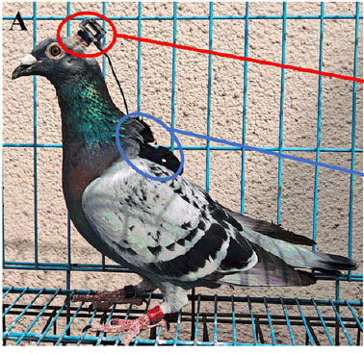
NEUR 411 · NEUROETHOLOGY · FALL 2026
Lecture 31
Navigation IV:
homing pigeon multimodal navigation
Friday, November 6, 2026
Jordan Lopez, Ph.D.
Professor of Neurobiology & Biomedical Engineering
Yang et al. (2025), Fig. 1A. A pigeon wearing the neural and positional recording devices.
Notes:
Navigation IV: homing pigeon multimodal navigation
Lecture 31. NEUR 411 · NEUROETHOLOGY · FALL 2026. Friday, November 6, 2026.
Figure: Yang et al. (2025), Fig. 1A. A pigeon wearing the neural and positional recording devices.
Figure source: https://doi.org/10.1523/JNEUROSCI.0185-25.2025

Slide 2
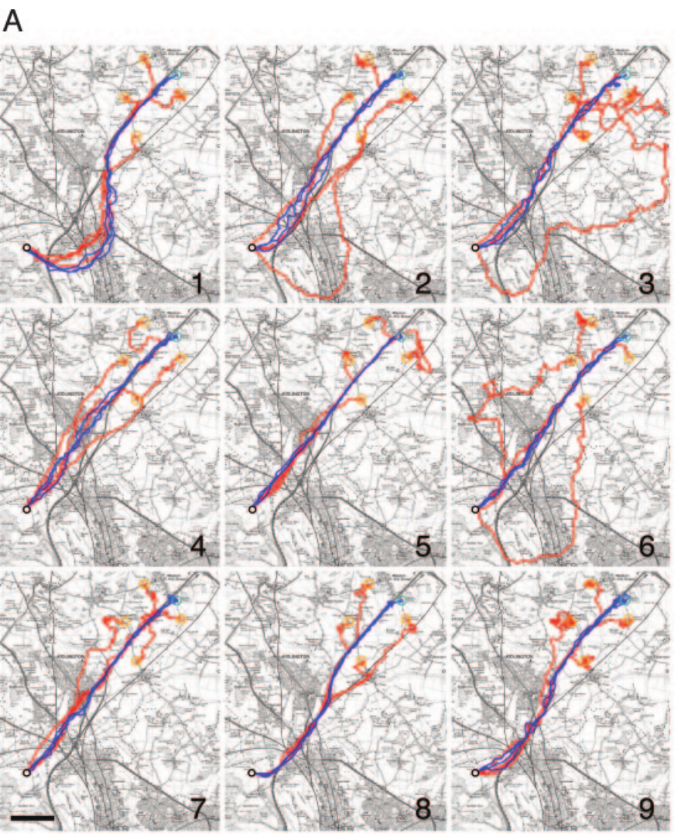
Homing uses location estimates and directional guidance
Homing is navigation back to a familiar home after displacement. In pigeons, a map estimates position relative to home, whereas a compass supplies a directional reference. Each term names a function rather than a physical structure, so a map can work without a complete mental picture of the landscape. A bird can use both systems together, and the two answer different questions about the same journey.
Biro and colleagues recorded homing pigeons with a global positioning system, or GPS, logging position every 1 s. Repeated releases and off-route tests separated the following of a familiar corridor from taking the shortest available course home. The tracks therefore show how a bird moves through a landscape it knows, not only where it ends up.
Birds repeatedly used individually distinctive routes rather than converging on one direct line. Route guidance of this kind can coexist with other sources of location and compass information. The GPS tracks describe the route itself, while the first sensory signal used at an unfamiliar release site is measured by separate tests.
Biro et al. (2004), Fig. 1A. Training and off-route homing tracks at Weston Wood.
Biro et al. (2004)
02
Notes:
• **Homing** is navigation back to a familiar home after displacement. In pigeons, a **map** estimates position relative to home, whereas a **compass** supplies a directional reference. These are functional distinctions; the word map does not by itself imply a complete mental representation of geography.
• Biro and colleagues recorded homing pigeons with a **global positioning system**, or GPS, logging position every 1 s. Repeated releases and off-route tests separated following a familiar corridor from taking the shortest available course home.
• Birds repeatedly used individually distinctive routes rather than converging on one direct line. Such route guidance can coexist with other location and compass information; the GPS tracks do not identify which sensory signal first establishes position at an unfamiliar release site.
References:
Biro D, Meade J, Guilford T (2004). Familiar route loyalty implies visual pilotage in the homing pigeon. Proceedings of the National Academy of Sciences 101(50):17440–17443. https://doi.org/10.1073/pnas.0406984101
Figure: Biro et al. (2004), Fig. 1A. Training and off-route homing tracks at Weston Wood.
Figure source: https://doi.org/10.1073/pnas.0406984101

Slide 3
Repeated journeys establish narrow individual corridors
Route fidelity is the repeated use of a similar path by the same animal. It is distinct from accuracy of arrival, because a pigeon can reach home along a reliable but indirect corridor. Biro and colleagues compared the last three training flights from each release site, which allowed the stability of each bird's path to be measured across many journeys.
After repeated homing experience, mean corridor widths were 151 m at Weston Wood and 176 m at High Cogges. These widths describe the area enclosed by each bird's final training tracks relative to its route length. The narrow widths show how consistently a pigeon returns to the same band of ground.
Tracks from the same bird were more similar to each other than tracks from different birds. Individuality points away from a single obligatory physical corridor. Shared terrain and weather constrain the available paths, yet each pigeon settles on its own route through them.
Biro et al. (2004), Fig. 1A. Training and off-route homing tracks at Weston Wood.
Biro et al. (2004)
03
Notes:
• **Route fidelity** is repeated use of a similar path by the same animal. It differs from accuracy of arrival: a pigeon can reach home along a reliable but indirect corridor. Biro and colleagues compared the last three training flights from each release site.
• After repeated homing experience, mean corridor widths were 151 m at Weston Wood and 176 m at High Cogges. These widths describe the area enclosed by each bird’s final training tracks relative to its route length, rather than the uncertainty of a neural location code.
• Tracks from the same bird were more similar than tracks from different birds. Individuality argues against a single obligatory physical corridor, although shared terrain and weather can still constrain available paths without determining the particular route learned by each pigeon.
References:
Biro D, Meade J, Guilford T (2004). Familiar route loyalty implies visual pilotage in the homing pigeon. Proceedings of the National Academy of Sciences 101(50):17440–17443. https://doi.org/10.1073/pnas.0406984101
Figure: Biro et al. (2004), Fig. 1A. Training and off-route homing tracks at Weston Wood.
Figure source: https://doi.org/10.1073/pnas.0406984101

Slide 4
Corridor width measures how consistent a route is
A corridor is the band of ground a bird covers repeatedly when it flies home along the same learned path. Its width describes how tightly a bird's training tracks cluster around one route. A narrow corridor means the bird returns to nearly the same ground on each journey, whereas a wide corridor means its paths vary more from flight to flight.
Biro and colleagues measured corridor widths from each bird's final training tracks, expressed relative to its route length. The average width was 151 m at Weston Wood and 176 m at High Cogges. Because the width is scaled to the route, routes of different lengths can be compared on one scale.
The corridor width therefore captures consistency in the flight path, not the accuracy of arrival at the loft. A pigeon can stay within a narrow corridor and still take an indirect route, so the width summarizes how repeatable the path is. The GPS records supply this measure directly from the tracks.
Biro et al. (2004), Fig. 1A. Training and off-route homing tracks at Weston Wood.
Biro et al. (2004)
03a
Notes:
• Corridor width is a property of the flight tracks themselves.
• Definition.
– A corridor is the band of ground covered on repeated flights along one learned path.
– A narrow band means the tracks cluster tightly.
• Measurement.
– Widths came from each bird's final training tracks.
– The widths were scaled to route length so that routes could be compared.
• Values.
– Mean widths were 151 m at Weston Wood and 176 m at High Cogges.
– Both values come from repeated training flights.
• Consistency and accuracy.
– A consistent route can still be indirect.
– The width measures repeatability, while arrival is a separate outcome.
• Data source.
– The GPS records supply the positions used for the widths.
– The measure follows directly from the recorded tracks.
• Meaning.
– Narrow corridors show that each bird keeps to its own route.
– The width gives a compact summary of that route.
• Source values.
– The published tracks and the measured values come from the original paper.
– Each value is reported with the scale used in the source.
• Why the measure matters.
– The result separates the bird's measured behavior from the mechanism that produces it.
– The comparison stays within the same birds or sites.
References:
Biro D, Meade J, Guilford T (2004). Familiar route loyalty implies visual pilotage in the homing pigeon. Proceedings of the National Academy of Sciences 101(50):17440–17443. https://doi.org/10.1073/pnas.0406984101

Slide 5
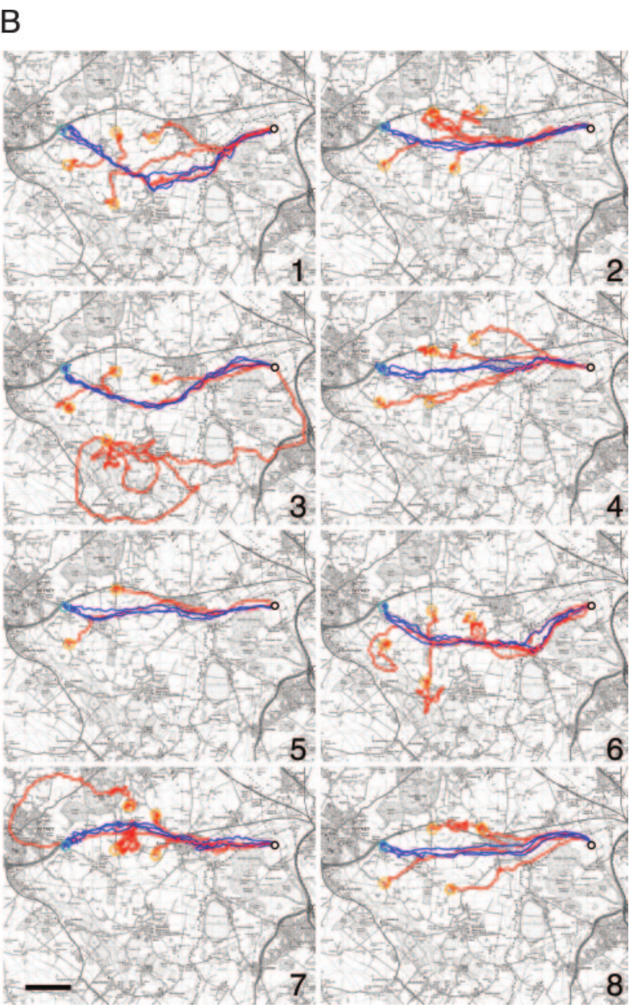
A familiar route need not minimize distance
Route efficiency compares the direct home distance with the distance actually flown. A lower value means a longer journey, even when the bird reaches the loft. Efficiency and fidelity therefore measure different properties of successful homing, so a bird can be consistent and still indirect.
Biro and colleagues found that final training routes remained indirect after 20 successive releases. Birds flew about 18–25% farther than the direct home distance while continuing to reproduce their individually distinctive paths. The GPS records kept the turns that a single departure bearing would miss.
Persistent detours support learned route guidance rather than a gradual convergence on the shortest path. The detours show that a learned corridor can outweigh the straight-line option. The ecological cost of the longer flights depends on factors such as visual reliability and risk along each route, and the study's measurements focus on the flight paths themselves.
Biro et al. (2004), Fig. 1B. Training and off-route homing tracks at High Cogges.
Biro et al. (2004)
04
Notes:
• **Route efficiency** compares the direct home distance with the distance actually flown. A lower value means a longer journey, even if the bird ultimately reaches the loft. Efficiency and fidelity therefore measure different properties of successful homing.
• Biro and colleagues found that final training routes remained indirect after 20 successive releases. Birds flew approximately 18–25% farther than the direct home distance, while continuing to reproduce their individually distinctive paths. The GPS records retained the turns that would be lost in a single departure bearing.
• Persistent detours support learned route guidance rather than progressive convergence on the shortest path. They do not establish that a detour is maladaptive: the experiment did not measure all ecological costs, visual reliability or risks along alternative routes.
References:
Biro D, Meade J, Guilford T (2004). Familiar route loyalty implies visual pilotage in the homing pigeon. Proceedings of the National Academy of Sciences 101(50):17440–17443. https://doi.org/10.1073/pnas.0406984101
Figure: Biro et al. (2004), Fig. 1B. Training and off-route homing tracks at High Cogges.
Figure source: https://doi.org/10.1073/pnas.0406984101

Slide 6
Off-route release tests attraction to a learned corridor
A displacement away from a trained release point separates recognition of the starting location from recognition of features along an established route. Biro and colleagues released trained pigeons at positions outside their preferred corridors and recorded the complete homing tracks. Each track shows whether the bird heads for the loft directly or first returns to familiar ground.
The off-route tracks often converged on the previously used route before continuing toward the loft. The maps include both the training tracks and the later test tracks, which allows each displacement to be compared with the surrounding landscape. The convergence occurred over a scale of about 2 km, so the pull of the route acts across a wide area.
Convergence fits attraction toward familiar visual landmarks rather than a newly selected direct course from the test site. Every off-route flight also drew on other navigational systems, which stayed available throughout the journey and helped each bird reach the loft.
Biro et al. (2004), Fig. 1A. Training and off-route homing tracks at Weston Wood.
Biro et al. (2004)
05
Notes:
• A displacement away from a trained release point separates recognition of the starting location from recognition of features along an established route. Biro and colleagues released trained pigeons at positions outside their preferred corridors and recorded their complete homing tracks.
• The off-route tracks often converged on the previously used route before continuing toward the loft. The original maps preserve both training tracks and later test tracks, with a 2 km scale for comparing the displacement with the surrounding landscape.
• Convergence is consistent with attraction toward familiar visual landmarks rather than a newly selected direct course from the test site. The experiment does not imply that every off-route flight used visual information exclusively, because other navigational systems remained available throughout the journey.
References:
Biro D, Meade J, Guilford T (2004). Familiar route loyalty implies visual pilotage in the homing pigeon. Proceedings of the National Academy of Sciences 101(50):17440–17443. https://doi.org/10.1073/pnas.0406984101
Figure: Biro et al. (2004), Fig. 1A. Training and off-route homing tracks at Weston Wood.
Figure source: https://doi.org/10.1073/pnas.0406984101

Slide 7
Convergence reveals a pull toward a learned corridor
Convergence is the movement of a displaced bird back toward a route it has flown before. In an off-route release, the bird begins far from its usual corridor, so any turn toward the old track shows what draws it. Biro and colleagues recorded the complete homing track of each pigeon to see whether it headed straight for the loft or first rejoined the familiar route.
Many off-route tracks merged with the previously used corridor before continuing toward home. The published maps show the training tracks alongside the test tracks at a scale of about 2 km, so each displacement can be read against the surrounding terrain. The merge happened far from the release point, which indicates that the route exerts its pull over a broad area.
The merging supports attraction toward familiar visual landmarks more than a fresh calculation of the shortest course. The pigeon reaches features it recognizes first and follows the route toward the loft afterward. Other navigational systems remained available during the same flights, so the convergence reflects a combination of guidance rather than one signal.
Biro et al. (2004), Fig. 1A. Training and off-route homing tracks at Weston Wood.
Biro et al. (2004)
05a
Notes:
• Displacement tests show what a bird goes back to.
• Off-route release.
– Each pigeon was released outside its preferred corridor.
– Its complete track shows the route it followed.
• Merging.
– Many tracks rejoined the previously used corridor.
– The rejoining happened well away from the release point.
• Scale.
– The maps use a scale of about 2 km.
– Each displacement can be compared with the surrounding landscape.
• Interpretation.
– The merge fits attraction toward recognized landmarks.
– A fresh shortest-path calculation does not explain the pattern.
• Other systems.
– Other navigational systems stayed available during the flights.
– The pull of the route is one part of the guidance.
• Route memory.
– The learned corridor shapes where the bird goes after displacement.
– The effect depends on the familiar features along the route.
• Source values.
– The published tracks and the measured values come from the original paper.
– Each value is reported with the scale used in the source.
• Why the measure matters.
– The result separates the bird's measured behavior from the mechanism that produces it.
– The comparison stays within the same birds or sites.
References:
Biro D, Meade J, Guilford T (2004). Familiar route loyalty implies visual pilotage in the homing pigeon. Proceedings of the National Academy of Sciences 101(50):17440–17443. https://doi.org/10.1073/pnas.0406984101

Slide 8
Pilotage links movement to recognized landmarks
Visual pilotage means using recognized landscape features to guide movement along a familiar route. A landmark can provide local guidance without placing the bird in a universal coordinate system. The route is learned as a succession of familiar places, and each place cues the next leg of the journey.
Biro and colleagues compared repeated training flights with off-route releases in the same landscape. Birds were drawn toward their preferred corridors even when that meant an indirect journey. The deviations were large compared with the small fluctuations around a single straight course, which shows that the corridors govern the flight.
The behavior supports route-based visual guidance, and the GPS tracks show how each bird moves along it. Each turn of the route is linked to a feature that the bird has learned. The sequence of those features forms the route memory that drives the flight.
Biro et al. (2004), Fig. 1B. Training and off-route homing tracks at High Cogges.
Biro et al. (2004)
06
Notes:
• **Visual pilotage** means using recognized landscape features to guide movement along a familiar route. A landmark can provide local guidance without representing the bird’s position in a universal coordinate system. The route may be learned as a succession of familiar places.
• Biro and colleagues compared repeated training flights with off-route releases in the same landscape. Birds were attracted toward their preferred corridors even when this required an indirect journey. The 2 km map scale places these deviations beyond small fluctuations around a single straight course.
• The behavior supports route-based visual guidance, but GPS alone cannot determine which particular feature controlled each turn. It also cannot distinguish a continuous visual panorama from a succession of discrete landmarks without additional manipulation of the visual information.
References:
Biro D, Meade J, Guilford T (2004). Familiar route loyalty implies visual pilotage in the homing pigeon. Proceedings of the National Academy of Sciences 101(50):17440–17443. https://doi.org/10.1073/pnas.0406984101
Figure: Biro et al. (2004), Fig. 1B. Training and off-route homing tracks at High Cogges.
Figure source: https://doi.org/10.1073/pnas.0406984101

Slide 9
Individual routes distinguish memory from common terrain
A common landscape can constrain flight without forcing all birds onto identical routes. Comparing different pigeons within the same terrain separates a shared environmental influence from an individual's accumulated experience with particular features. The shared terrain sets the outer bounds, and the learned route sets the path inside them.
The training and off-route maps contain clearly different paths for pigeons returning to the same loft. Within-bird training corridors averaged 151 m at Weston Wood, whereas routes from different birds overlapped much less. The geographical target was shared, while each bird's preferred trajectory was its own.
This comparison supports an acquired route memory rather than a single obligatory terrain channel. The individual corridors show that experience shapes each pigeon's path, and the same destination can be reached along many different learned routes.
Biro et al. (2004), Fig. 1A. Training and off-route homing tracks at Weston Wood.
Biro et al. (2004)
07
Notes:
• A common landscape can constrain flight without forcing all birds onto identical routes. Comparing different pigeons within that same terrain separates a shared environmental influence from an individual’s accumulated experience with particular features.
• The training and off-route maps contain clearly different paths for pigeons returning to the same loft. Within-bird training corridors averaged 151 m at Weston Wood, whereas routes from different birds overlapped less closely. The geographical target was shared while the preferred trajectory was individual.
• This comparison supports an acquired route memory rather than a single obligatory terrain channel. It does not specify the memory’s neural location or prove that all routes were learned independently of social experience; the tracked tests concern individual expression of homing behavior.
References:
Biro D, Meade J, Guilford T (2004). Familiar route loyalty implies visual pilotage in the homing pigeon. Proceedings of the National Academy of Sciences 101(50):17440–17443. https://doi.org/10.1073/pnas.0406984101
Figure: Biro et al. (2004), Fig. 1A. Training and off-route homing tracks at Weston Wood.
Figure source: https://doi.org/10.1073/pnas.0406984101

Slide 10
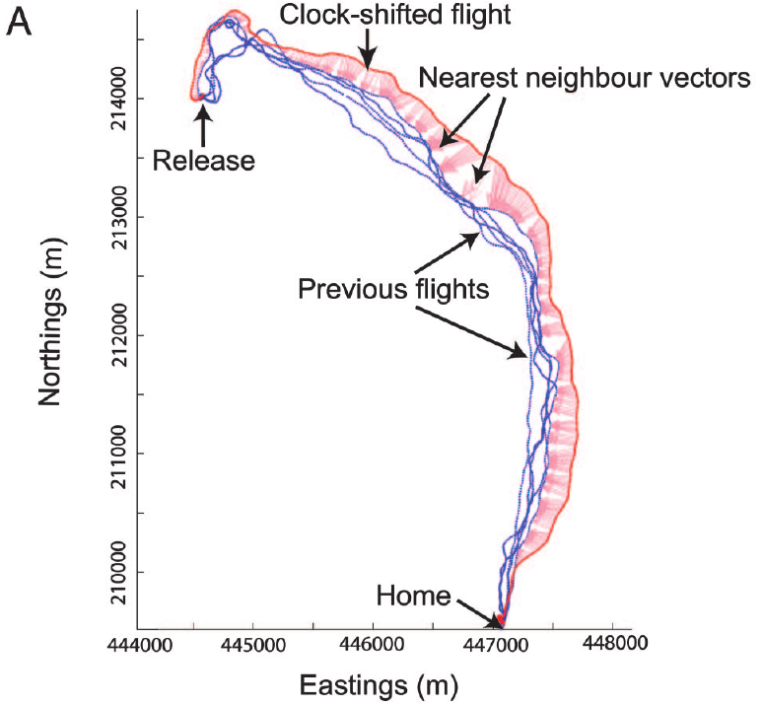
Clock shift makes solar direction conflict with landmarks
A time-compensated sun compass uses the sun's position together with internal time to estimate direction. Because the solar position changes across the day, altering the bird's internal clock changes the direction it infers while the landscape stays the same. The clock therefore becomes a source of directional conflict.
Biro and colleagues delayed artificial sunrise and sunset by 4 h for 5–7 days. This treatment predicted a solar-compass error of approximately 90° on the release dates. GPS tracks after treatment were compared with each bird's own earlier flights, so every pigeon served as its own control.
The manipulation sets a familiar visual route against the compass information. A displaced course shows that the bird keeps using time-dependent directional information even when it conflicts with the landmarks it knows. The landmarks and other cues remain present, so the sun is one of several sources the bird combines.
Biro et al. (2007), Fig. 2A. A clock-shifted track and nearest-neighbour vectors.
Biro et al. (2007)
08
Notes:
• A **time-compensated sun compass** uses the sun’s position together with internal time to estimate direction. Because solar position changes across the day, altering the bird’s internal clock can change its inferred direction while leaving the landscape physically unchanged.
• Biro and colleagues delayed artificial sunrise and sunset by 4 h for 5–7 days. This treatment predicted a solar-compass error of approximately 90° at the release dates. GPS tracks after treatment were compared with each bird’s own earlier flights.
• The manipulation creates a conflict between a familiar visual route and compass information. A displaced course supports continued use of time-dependent directional information, but the treatment does not remove landmarks or establish that the sun is the only remaining compass cue.
References:
Biro D, Freeman R, Meade J, Roberts S, Guilford T (2007). Pigeons combine compass and landmark guidance in familiar route navigation. Proceedings of the National Academy of Sciences 104(18):7471–7476. https://doi.org/10.1073/pnas.0701575104
Figure: Biro et al. (2007), Fig. 2A. A clock-shifted track and nearest-neighbour vectors.
Figure source: https://doi.org/10.1073/pnas.0701575104

Slide 11
Time-compensated sun compass uses the sun and clock
A time-compensated sun compass combines the sun's position with the bird's internal sense of time to estimate a direction. The sun moves across the sky at a steady rate, so the same solar position corresponds to a different compass direction at a different hour. Keeping the internal clock matched to local time keeps the sun compass accurate.
Biro and colleagues shifted the birds' clock by delaying artificial sunrise and sunset by 4 h for 5–7 days. The shift predicted a solar-compass error of about 90° on the release dates. The tracks after treatment were compared with each bird's earlier flights, so every pigeon's own route served as the baseline.
The clock shift sets the sun compass against the landmarks that the bird recognizes. A bird that follows its familiar route ignores part of the compass error, whereas a bird that trusts the compass moves away from the route. The contrast shows that the sun is one source among several that the pigeon combines.
Biro et al. (2007), Fig. 2A. A clock-shifted track and nearest-neighbour vectors.
Biro et al. (2007)
08a
Notes:
• The sun compass depends on time as well as on the sun.
• Principle.
– The sun's position changes steadily through the day.
– A bird must know the time to read the sun correctly.
• Manipulation.
– Artificial sunrise and sunset were delayed by 4 h.
– The delay lasted 5–7 days.
• Prediction.
– The shift predicted a solar-compass error of about 90°.
– The predicted error is the size of the directional conflict.
• Controls.
– Each pigeon was compared with its own earlier flights.
– This keeps individual routes as the reference.
• Conflict.
– The familiar route and the compass point in different directions.
– The bird's track shows which one it follows.
• Combination.
– The sun is one of several cues that the bird weighs.
– Landmarks and other cues remain available.
• Source values.
– The published tracks and the measured values come from the original paper.
– Each value is reported with the scale used in the source.
• Why the measure matters.
– The result separates the bird's measured behavior from the mechanism that produces it.
– The comparison stays within the same birds or sites.
References:
Biro D, Freeman R, Meade J, Roberts S, Guilford T (2007). Pigeons combine compass and landmark guidance in familiar route navigation. Proceedings of the National Academy of Sciences 104(18):7471–7476. https://doi.org/10.1073/pnas.0701575104

Slide 12
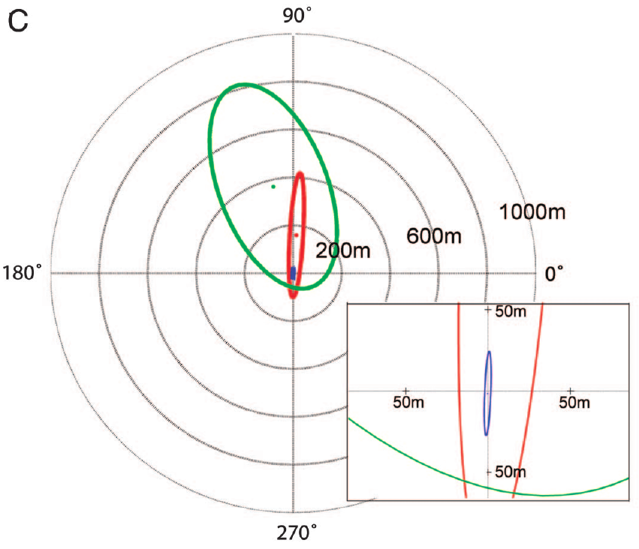
Experience changes the effect of conflicting cues
Cue weighting describes the relative influence of different information sources on behavior. It can operate without a conscious decision or a single neuron that assigns numerical weights. Familiarity can change how strongly a recognized route constrains compass-guided movement, which makes the balance between cues depend on experience.
Biro and colleagues compared high-familiarity birds with low-familiarity birds at four sites 5.1–10.6 km from the loft. After the same clock shift, highly familiar birds generally stayed closer to their previous tracks, whereas less familiar birds deviated farther. The contrast shows that experience changes the outcome of the same conflict.
The comparison supports an experience-dependent interaction between landmark guidance and the solar compass. The size of the treatment effect depended on the release site and the layout of the surrounding landscape, so the balance of cues is shaped by both experience and place.
Biro et al. (2007), Fig. 2C. Route displacement distributions by familiarity and clock treatment.
Biro et al. (2007)
09
Notes:
• **Cue weighting** describes the relative influence of different information sources on behavior. It need not imply a conscious decision or a single identifiable neuron that assigns numerical weights. Familiarity can alter how strongly a recognized route constrains compass-guided movement.
• Biro and colleagues compared high-familiarity birds with low-familiarity birds at four sites 5.1–10.6 km from the loft. After the same clock shift, highly familiar birds generally remained closer to their previous tracks, whereas less familiar birds deviated farther.
• The comparison supports experience-dependent interaction between landmark guidance and the solar compass. It does not establish a universal weighting rule, because the magnitude of the treatment effect also depended on the release site and the geometry of its surrounding landscape.
References:
Biro D, Freeman R, Meade J, Roberts S, Guilford T (2007). Pigeons combine compass and landmark guidance in familiar route navigation. Proceedings of the National Academy of Sciences 104(18):7471–7476. https://doi.org/10.1073/pnas.0701575104
Figure: Biro et al. (2007), Fig. 2C. Route displacement distributions by familiarity and clock treatment.
Figure source: https://doi.org/10.1073/pnas.0701575104

Slide 13
Nearest-neighbour vectors quantify route displacement
A nearest-neighbour vector connects a recorded point on one flight to the closest point on a comparison flight. Its length measures the spatial separation between the two flights. Its angle relative to the current flight direction shows whether the bird is displaced to one side or lies ahead or behind its earlier position.
Biro and colleagues calculated these vectors for clock-shifted flights and for earlier GPS tracks. The source axes express eastings and northings in metres, which preserves the route geometry instead of reducing the flight to a single departure angle. The geometry therefore keeps the full shape of each journey.
This analysis tests whether a shifted bird stays near its learned corridor throughout the trip. The vectors are measurements made by the investigators, and they describe the separation between two paths in space. Each vector therefore records one separation between two flights, and the set of vectors describes how far the whole route moved.
Biro et al. (2007), Fig. 2A. A clock-shifted track and nearest-neighbour vectors.
Biro et al. (2007)
10
Notes:
• A **nearest-neighbour vector** connects a recorded point on one flight to the closest point on a comparison flight. Its length measures spatial separation. Its angle relative to current flight direction distinguishes a lateral displacement from separation ahead or behind the bird.
• Biro and colleagues calculated these vectors for clock-shifted flights and earlier GPS tracks. The source axes express eastings and northings in metres, preserving route geometry rather than reducing the flight to a single departure angle.
• This analysis tests whether a shifted bird remains near its learned corridor throughout travel. The vectors are investigators’ measurements, not evidence that the pigeon computes the same geometrical operation or represents its route as a stored array of GPS coordinates.
References:
Biro D, Freeman R, Meade J, Roberts S, Guilford T (2007). Pigeons combine compass and landmark guidance in familiar route navigation. Proceedings of the National Academy of Sciences 104(18):7471–7476. https://doi.org/10.1073/pnas.0701575104
Figure: Biro et al. (2007), Fig. 2A. A clock-shifted track and nearest-neighbour vectors.
Figure source: https://doi.org/10.1073/pnas.0701575104

Slide 14
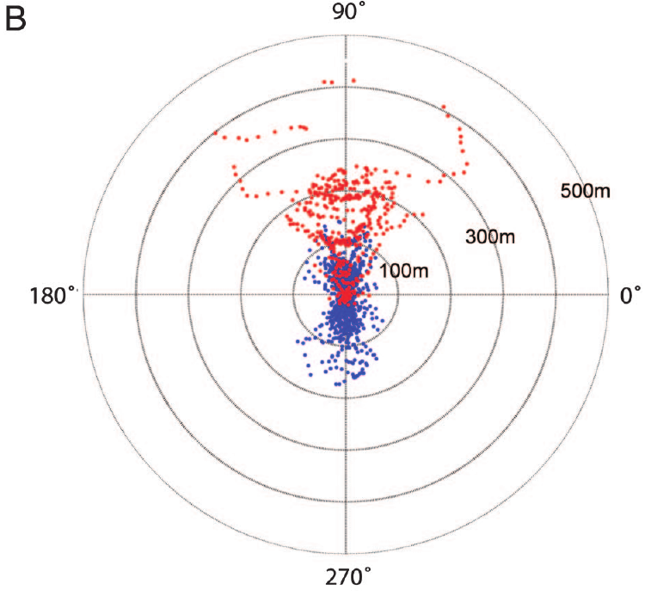
Parallel offsets preserve route shape under clock shift
A parallel offset occurs when a flight keeps the shape of a previous route while moving consistently to one side of it. Such a trajectory differs from a full abandonment of the route in favor of a straight, compass-directed flight. The bird keeps the route's form and shifts its position.
After clock shift, some highly familiar pigeons followed paths displaced to the anticlockwise side of their former tracks. The route-relative vectors retained this lateral bias, with distances in metres and reference rings at 100, 300 and 500 m. The rings make the size of each offset easy to compare.
The combination fits landmark attraction and compass influence operating together. The shape of the route is kept while the position shifts, which points to two sources of guidance working at the same time. The bird recognizes its learned features and still responds to the time-shifted compass.
Biro et al. (2007), Fig. 2B. Route-relative distances and angles before and after clock shift.
Biro et al. (2007)
11
Notes:
• A **parallel offset** occurs when a flight retains the shape of a previous route while moving consistently to one side of it. Such a trajectory differs from complete abandonment of the route in favor of a straight compass-directed flight.
• After clock shift, some highly familiar pigeons followed paths displaced to the anticlockwise side of their former tracks. The route-relative vectors retained this lateral bias, with distances expressed in metres and reference rings at 100, 300 and 500 m.
• The combination is consistent with landmark attraction and compass influence operating together. The tracks cannot distinguish continuous neural integration from rapid switching between sources, and preservation of shape does not prove that the bird recognizes every particular landmark along the route.
References:
Biro D, Freeman R, Meade J, Roberts S, Guilford T (2007). Pigeons combine compass and landmark guidance in familiar route navigation. Proceedings of the National Academy of Sciences 104(18):7471–7476. https://doi.org/10.1073/pnas.0701575104
Figure: Biro et al. (2007), Fig. 2B. Route-relative distances and angles before and after clock shift.
Figure source: https://doi.org/10.1073/pnas.0701575104

Slide 15
Parallel offsets keep shape while shifting position
A parallel offset is a flight that keeps the shape of an earlier route while sitting consistently to one side of it. The bird does not abandon its route for a new straight line. It maintains the sequence of turns and the overall form, and only the position changes.
After the clock shift, some highly familiar pigeons flew parallel to their former tracks on the anticlockwise side. Route-relative vectors measured the lateral offset in metres, with reference rings at 100, 300 and 500 m that make each displacement easy to compare. The offsets were consistent across the birds that showed them.
Parallel offsets indicate that landmark attraction and compass influence act together during the journey. The bird keeps its learned route shape while the compass shifts the whole route sideways. A flight of this kind combines recognition of features with a directional correction.
Biro et al. (2007), Fig. 2B. Route-relative distances and angles before and after clock shift.
Biro et al. (2007)
11a
Notes:
• A parallel offset separates the shape of a route from its position.
• Definition.
– The bird keeps the shape of its earlier route.
– The whole route is moved to one side.
• Measurement.
– Vectors were calculated relative to the route.
– Rings at 100, 300 and 500 m mark the size of the offset.
• Direction.
– Some pigeons shifted anticlockwise of their former tracks.
– The bias was retained in the route-relative vectors.
• Two sources.
– Landmark attraction keeps the shape.
– Compass influence moves the position.
• Contrast.
– A straight compass flight would abandon the route shape.
– The offsets do not do that.
• Meaning.
– Route memory and the compass operate together.
– Each flight shows the balance between them.
• Source values.
– The published tracks and the measured values come from the original paper.
– Each value is reported with the scale used in the source.
• Why the measure matters.
– The result separates the bird's measured behavior from the mechanism that produces it.
– The comparison stays within the same birds or sites.
References:
Biro D, Freeman R, Meade J, Roberts S, Guilford T (2007). Pigeons combine compass and landmark guidance in familiar route navigation. Proceedings of the National Academy of Sciences 104(18):7471–7476. https://doi.org/10.1073/pnas.0701575104

Slide 16
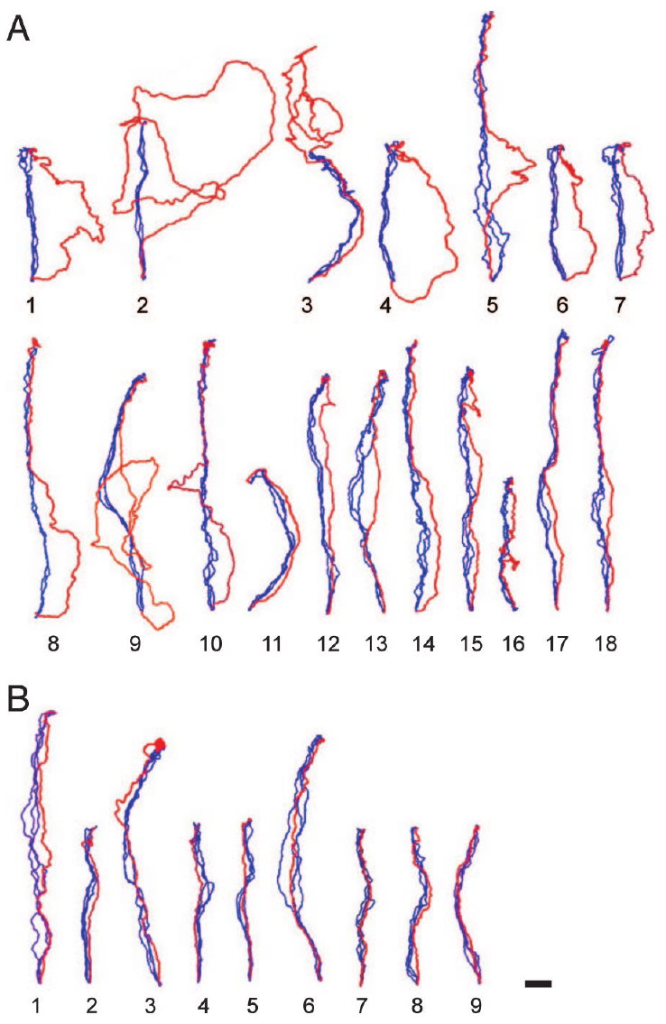
The same manipulation produces different individual routes
Group averages can hide distinct individual responses to conflicting cues. In Biro and colleagues' experiment, each highly familiar pigeon's final training flights were compared with its single clock-shifted test flight. This pairing separates the parts of the route that were kept from the parts that were disrupted.
Some shifted pigeons deviated prominently from the learned corridor, some followed parallel offsets, and others reproduced their earlier route closely. The published tracks were rotated to a common release-to-home orientation and carry a 1 km scale for spatial comparison. The rotation allows each response to be compared on equal terms.
These differences favor a flexible account in which familiarity changes how much the compass affects a given bird. An individual response also depends on the route geometry, the local visibility and the particular test conditions, so each pigeon's route reflects several factors together.
Biro et al. (2007), Fig. 3A–B. Individual homing tracks before and after clock shift.
Biro et al. (2007)
12
Notes:
• Group averages can conceal distinct individual responses to conflicting cues. In Biro and colleagues’ experiment, each highly familiar pigeon’s final training flights were compared with its single clock-shifted test flight, allowing retention and disruption of route shape to be separated.
• Some shifted pigeons deviated prominently from the learned corridor, some followed parallel offsets, and others reproduced their earlier route closely. The published tracks were rotated to a common release-to-home orientation and retain a 1 km scale for spatial comparison.
• These differences constrain a binary account in which familiarity either eliminates compass influence or leaves it unchanged. They do not identify stable sensory types among pigeons, because an individual response can also depend on route geometry, local visibility and the particular test conditions.
References:
Biro D, Freeman R, Meade J, Roberts S, Guilford T (2007). Pigeons combine compass and landmark guidance in familiar route navigation. Proceedings of the National Academy of Sciences 104(18):7471–7476. https://doi.org/10.1073/pnas.0701575104
Figure: Biro et al. (2007), Fig. 3A–B. Individual homing tracks before and after clock shift.
Figure source: https://doi.org/10.1073/pnas.0701575104

Slide 17
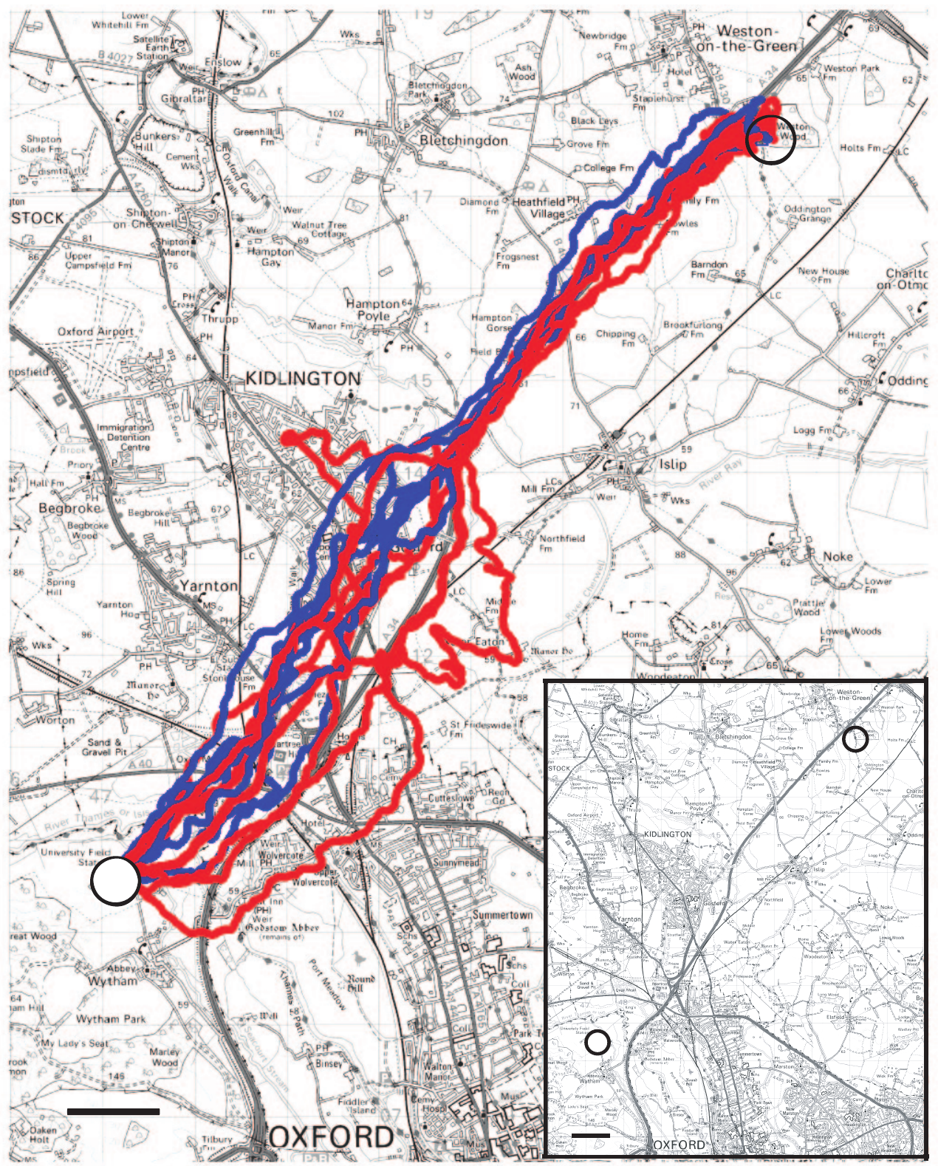
Compass effects can emerge after departure
An initial departure bearing samples only one part of a homing journey. Landmark and compass influences can change after a bird has already entered a familiar corridor. A bird that leaves in the right direction can still deviate later, so the start of a journey does not capture its full course.
At Weston Wood, some highly familiar pigeons first followed their route after the clock shift and deviated later. Complete GPS trajectories retained this delayed effect, which a bearing taken only as the bird left the release site would have missed. The map carries a 1 km scale.
The timing points to continued interaction between cues during travel rather than recognition of the release point alone. The delayed deviations show that the bird keeps updating its heading along the route, and the complete track is needed to see the change.
Biro et al. (2007), Fig. 4. Weston Wood routes before and after clock shift.
Biro et al. (2007)
13
Notes:
• An initial departure bearing samples only one portion of a homing journey. Landmark and compass influences can change after a bird has already entered a familiar corridor, so absence of an early deviation does not establish absence of compass use.
• At Weston Wood, some highly familiar pigeons initially recapitulated their route after clock shift and deviated later. Complete GPS trajectories retained this delayed effect, whereas a bearing taken only as the bird left the release site could miss it. The map retains a 1 km scale.
• The timing argues for continued interaction during travel rather than recognition of the release point alone. It does not establish precisely when the internal conflict was detected or which neural process caused the later change in route position.
References:
Biro D, Freeman R, Meade J, Roberts S, Guilford T (2007). Pigeons combine compass and landmark guidance in familiar route navigation. Proceedings of the National Academy of Sciences 104(18):7471–7476. https://doi.org/10.1073/pnas.0701575104
Figure: Biro et al. (2007), Fig. 4. Weston Wood routes before and after clock shift.
Figure source: https://doi.org/10.1073/pnas.0701575104

Slide 18
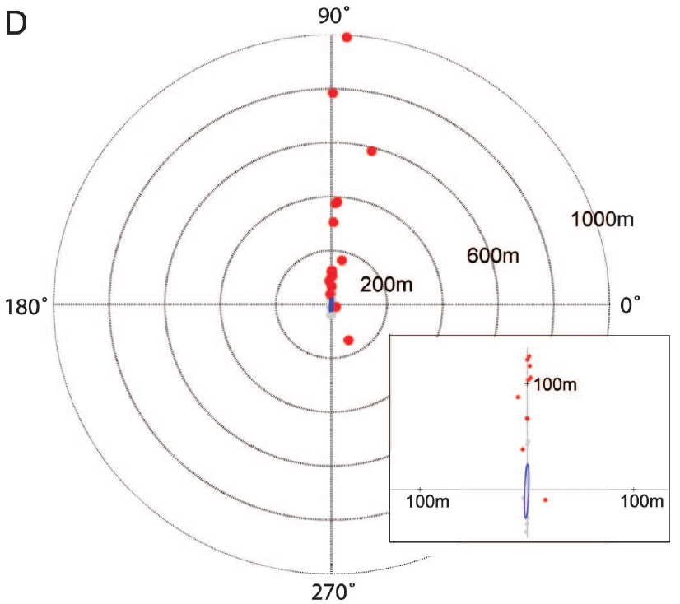
Familiar navigation combines guidance systems
Multimodal navigation uses information from more than one sensory system. In familiar pigeon routes, visual landmarks constrain movement while a time-dependent compass continues to influence heading. A recognized landscape does not silence every other directional source, so several systems contribute to each flight.
The 4 h clock shift produced individual displacement vectors that ranged from little route change to pronounced lateral offsets. Many highly familiar birds stayed close to their previous tracks despite the predicted solar-compass error of about 90°. The spread across birds shows that the same manipulation produced a range of responses.
The evidence supports combined guidance, with the landmark route acting as a stable reference. A tolerance around the familiar corridor could allow some compass-driven displacement, and the trajectories show how that tolerance appears in each bird's path.
Biro et al. (2007), Fig. 2D. Individual route displacement after clock shift.
Biro et al. (2007)
14
Notes:
• **Multimodal navigation** uses information from more than one sensory system. In familiar pigeon routes, visual landmarks can constrain movement while a time-dependent compass continues to influence heading. A recognized landscape does not necessarily silence every other directional source.
• Biro and colleagues’ 4 h clock shift produced individual displacement vectors ranging from little route change to pronounced lateral offsets. Many highly familiar birds stayed close to previous tracks despite the predicted approximately 90° solar-compass error.
• The evidence supports combined guidance while leaving its implementation unresolved. A proposed tolerance around the familiar corridor could permit some compass-driven displacement, but this is an interpretation of trajectories rather than a directly measured neural integration circuit.
References:
Biro D, Freeman R, Meade J, Roberts S, Guilford T (2007). Pigeons combine compass and landmark guidance in familiar route navigation. Proceedings of the National Academy of Sciences 104(18):7471–7476. https://doi.org/10.1073/pnas.0701575104
Figure: Biro et al. (2007), Fig. 2D. Individual route displacement after clock shift.
Figure source: https://doi.org/10.1073/pnas.0701575104

Slide 19
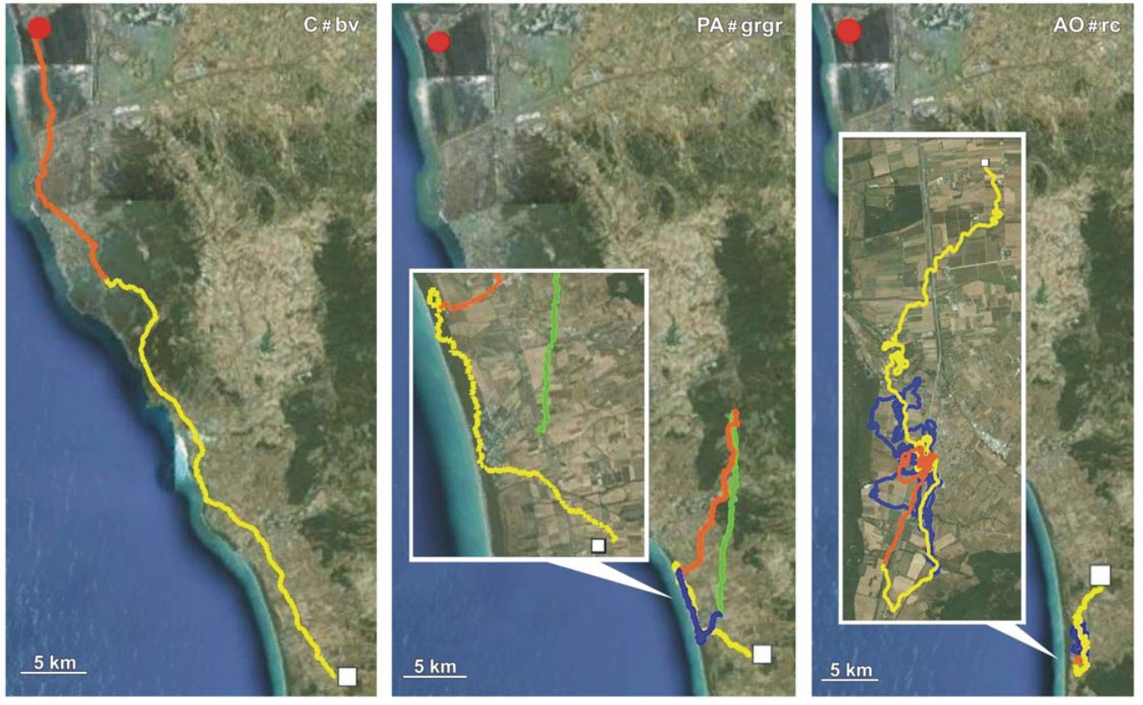
Odor treatments separate information from activation
An olfactory map uses learned environmental odor information to estimate position relative to home. An olfactory activation hypothesis proposes instead that smelling unfamiliar odors enables navigation based on other cues, even when the smells carry no location information. The two accounts make different predictions for the same odor exposure.
Gagliardo and colleagues transported pigeons in containers supplied with natural air, charcoal-filtered air or filtered air plus artificial plant odors. Artificial odor puffs were supplied about every 20 min during transport and while the birds waited at the release site. Each group therefore received a different odor history before release.
Natural air and artificial odors both stimulated the sense of smell, but only natural air carried the geographical odor mixture. Comparing the later tracks tests whether sensory activation alone is sufficient, and the results show whether the environmental chemicals provided usable location information.
Gagliardo et al. (2011), Fig. 1. Homing tracks after natural air, filtered air or artificial odors.
Gagliardo et al. (2011)
15
Notes:
• An **olfactory map** uses learned environmental odor information to estimate position relative to home. An **olfactory activation hypothesis** instead proposes that smelling unfamiliar odors enables navigation based on other cues, even when the smells themselves contain no location information.
• Gagliardo and colleagues transported pigeons in containers supplied with natural air, charcoal-filtered air or filtered air plus artificial plant odors. Artificial odor puffs were supplied about every 20 min during transport and waiting at the release site.
• Natural air and artificial odors therefore both stimulated smell, but only natural air retained the geographical odor mixture. Comparing subsequent tracks tested whether sensory activation alone was sufficient under this preparation; it did not identify which environmental chemicals conveyed usable location information.
References:
Gagliardo A, Ioalè P, Filannino C, Wikelski M (2011). Homing pigeons only navigate in air with intact environmental odours: a test of the olfactory activation hypothesis with GPS data loggers. PLOS ONE 6(8):e22385. https://doi.org/10.1371/journal.pone.0022385
Figure: Gagliardo et al. (2011), Fig. 1. Homing tracks after natural air, filtered air or artificial odors.
Figure source: https://doi.org/10.1371/journal.pone.0022385

Slide 20
Olfactory map versus activation hypothesis
An olfactory map uses learned odor information to estimate position relative to home, so the smell of a place carries location. An olfactory activation hypothesis proposes that the mere experience of unfamiliar odors helps navigation, even when the odors carry no location information. The two accounts predict different results when the odor history is changed.
Gagliardo and colleagues transported pigeons in containers supplied with natural air, charcoal-filtered air or filtered air with artificial plant odors. Artificial odor puffs were supplied about every 20 min during transport and while the birds waited at the release site. Each group therefore carried a different odor history into the release.
The activation account predicts that artificial odors should help as much as natural air. The map account predicts that only the natural mixture helps, because only natural air carries the geographical odor signature. The later tracks decide between these predictions.
Gagliardo et al. (2011), Fig. 1. Homing tracks after natural air, filtered air or artificial odors.
Gagliardo et al. (2011)
15a
Notes:
• The two odor accounts make different predictions.
• Map account.
– Odors carry location through their mixture.
– Only natural air holds the geographical signature.
• Activation account.
– Any unfamiliar odor stimulates the sense of smell.
– Stimulation alone may help navigation.
• Transport.
– Birds were carried in containers with different air supplies.
– Artificial odors were added in puffs about every 20 min.
• Waiting period.
– The same air conditions applied while birds waited at the release site.
– The odor history continued up to release.
• Comparison.
– The later tracks show which prediction holds.
– The groups differ only in the air they received.
• Outcome.
– The result depends on whether location information was present.
– Sensory stimulation alone was tested as a separate condition.
• Source values.
– The published tracks and the measured values come from the original paper.
– Each value is reported with the scale used in the source.
• Why the measure matters.
– The result separates the bird's measured behavior from the mechanism that produces it.
– The comparison stays within the same birds or sites.
References:
Gagliardo A, Ioalè P, Filannino C, Wikelski M (2011). Homing pigeons only navigate in air with intact environmental odours: a test of the olfactory activation hypothesis with GPS data loggers. PLOS ONE 6(8):e22385. https://doi.org/10.1371/journal.pone.0022385

Slide 21
Temporary anosmia restricts access to new flight odors
Anosmia is the loss of the ability to smell. Gagliardo and colleagues anesthetized the olfactory mucosa, the nasal tissue that detects odors, with Xylocaine immediately before release. The same treatment was given to all three air-exposure groups, so the nasal block was a common condition.
The birds had already experienced natural air, filtered air or artificial odors during transport and before takeoff. Releases occurred at sites 53 km and 61 km from home. The common nasal block reduced new odor sampling during early flight while the differences in prior exposure remained.
The design focuses the comparison on the information acquired before release. Because the local anesthesia wears off, the later flight reflects smell returning as well as navigation during the early period, so the timing of recovery is part of the record.
Gagliardo et al. (2011), Fig. 1. Homing tracks after natural air, filtered air or artificial odors.
Gagliardo et al. (2011)
16
Notes:
• **Anosmia** is loss of the ability to smell. Gagliardo and colleagues anesthetized the olfactory mucosa, the nasal sensory tissue that detects odors, with Xylocaine immediately before release. This treatment was applied to all three air-exposure groups.
• Birds had already experienced natural air, filtered air or artificial odors during transport and before takeoff. Release occurred at sites 53 km and 61 km from home. The common nasal treatment reduced new odor sampling during early flight while preserving differences in prior exposure.
• The design concentrates the comparison on information acquired before release. Because local anesthesia wears off, later flight cannot be treated as permanently odor-free; a delayed homeward correction may follow recovery of smell rather than accurate navigation during the initial treatment period.
References:
Gagliardo A, Ioalè P, Filannino C, Wikelski M (2011). Homing pigeons only navigate in air with intact environmental odours: a test of the olfactory activation hypothesis with GPS data loggers. PLOS ONE 6(8):e22385. https://doi.org/10.1371/journal.pone.0022385
Figure: Gagliardo et al. (2011), Fig. 1. Homing tracks after natural air, filtered air or artificial odors.
Figure source: https://doi.org/10.1371/journal.pone.0022385

Slide 22
Natural environmental odors support early homing
A useful odor treatment must improve navigation rather than merely induce movement. Gagliardo and colleagues recorded GPS tracks at 1 Hz after releasing pigeons exposed to different air conditions. The same temporary nasal anesthesia was applied across groups, so the tracks compare the earlier odor histories directly.
Control birds exposed to intact environmental odors showed better homeward movement during the first hour. Filtered-air and artificial-odor birds navigated less well at the start, even though the artificial odors provided repeated olfactory stimulation. The tracks keep a 5 km scale and the time sequence of movement.
The outcome points to a specific navigational contribution of environmental odors under these conditions. In familiar terrain, recognized landmarks supply a different form of guidance, so the contribution of odor depends on the surroundings.
Gagliardo et al. (2011), Fig. 1. Homing tracks after natural air, filtered air or artificial odors.
Gagliardo et al. (2011)
17
Notes:
• A useful odor treatment must improve navigation rather than merely induce movement. Gagliardo and colleagues recorded GPS tracks at 1 Hz after releasing pigeons exposed to different air conditions, with the same temporary nasal anesthesia applied across groups.
• Control birds exposed to intact environmental odors showed better homeward movement during the first hour. Filtered-air and artificial-odor birds displayed poorer initial navigation, despite artificial odors providing repeated olfactory stimulation. Tracks retain a 5 km scale and the time sequence of movement.
• The outcome supports a specific navigational contribution of environmental odors under these conditions. It does not prove that olfaction always dominates every pigeon journey, especially in familiar terrain where recognized landmarks can supply a different form of guidance.
References:
Gagliardo A, Ioalè P, Filannino C, Wikelski M (2011). Homing pigeons only navigate in air with intact environmental odours: a test of the olfactory activation hypothesis with GPS data loggers. PLOS ONE 6(8):e22385. https://doi.org/10.1371/journal.pone.0022385
Figure: Gagliardo et al. (2011), Fig. 1. Homing tracks after natural air, filtered air or artificial odors.
Figure source: https://doi.org/10.1371/journal.pone.0022385

Slide 23
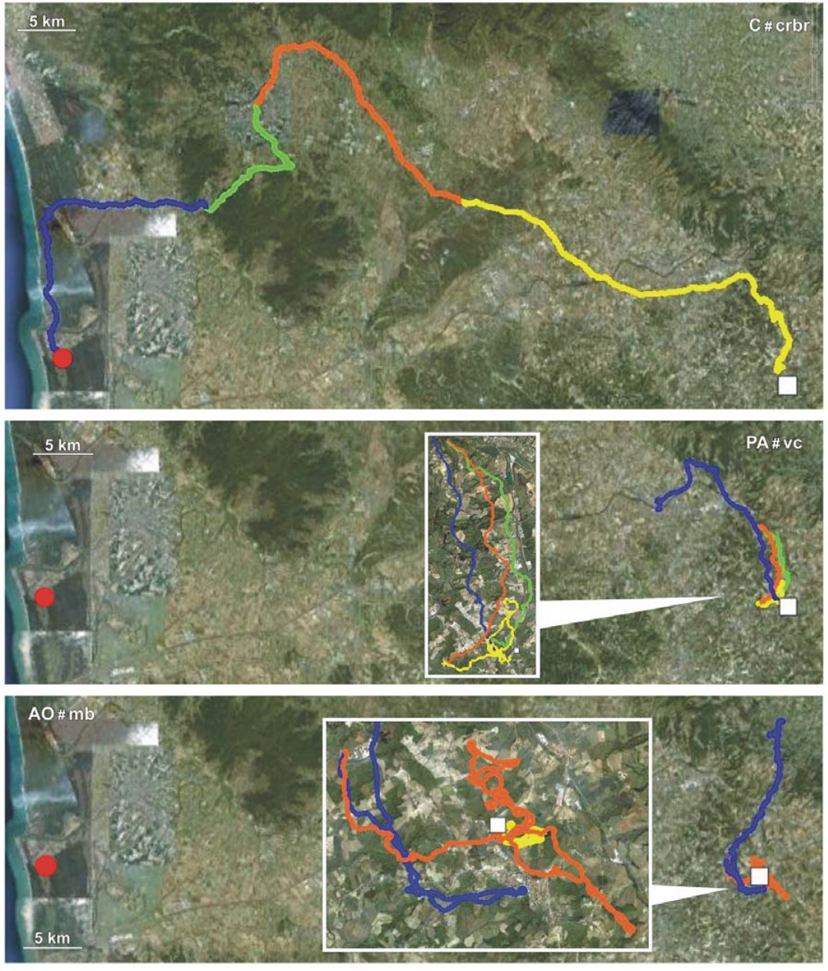
Artificial odors do not restore navigational information
Artificial odors can stimulate olfactory receptors without reproducing the natural relationship between odor mixtures and geographical position. In Gagliardo and colleagues' experiment, plant odors were delivered in filtered air during transport and the waiting period before release. The odors therefore stimulated the nose without carrying the landscape's signature.
The artificial-odor group performed worse than controls exposed to environmental air at both the 53 km and 61 km release sites. Its GPS tracks often remained tortuous or close to the release point rather than progressing reliably homeward during the first hour.
The result contradicts a simple activation-only prediction in this preparation. Stimulation strength, odor history and the type of navigational task all shape how an olfactory treatment affects behavior, so the effect of unfamiliar smells depends on those conditions.
Gagliardo et al. (2011), Fig. 2. Contrasting routes after the three odor treatments.
Gagliardo et al. (2011)
18
Notes:
• Artificial odors can stimulate olfactory receptors without reproducing the natural relationship between odor mixtures and geographical position. In Gagliardo and colleagues’ experiment, plant odors were delivered in filtered air during transport and the pre-release waiting period.
• The artificial-odor group did not match controls exposed to environmental air at either the 53 km or 61 km release site. Its GPS tracks often remained tortuous or near release rather than progressing reliably homeward during the first hour.
• This failure contradicts a simple activation-only prediction for this preparation. It does not demonstrate that unfamiliar smells can never modulate navigation, because stimulation strength, odor history and the type of navigational task can influence how an olfactory treatment affects behavior.
References:
Gagliardo A, Ioalè P, Filannino C, Wikelski M (2011). Homing pigeons only navigate in air with intact environmental odours: a test of the olfactory activation hypothesis with GPS data loggers. PLOS ONE 6(8):e22385. https://doi.org/10.1371/journal.pone.0022385
Figure: Gagliardo et al. (2011), Fig. 2. Contrasting routes after the three odor treatments.
Figure source: https://doi.org/10.1371/journal.pone.0022385

Slide 24
Nasal anesthesia applies the same block to all groups
A nasal block removes the sense of smell for a short time by anesthetizing the olfactory mucosa. Gagliardo and colleagues applied Xylocaine immediately before release, so every pigeon lost new odor input during early flight. Because the block was the same across groups, any difference between the groups must come from the odors they experienced before release.
The birds had already been exposed to natural air, filtered air or artificial odors during transport and before takeoff. Releases occurred at sites 53 km and 61 km from home. The shared block limited new odor sampling while the earlier exposure differences stayed in place.
This design isolates the effect of prior odor history on navigation. The anesthesia wears off, so the later part of the flight reflects smell returning, and the timing of that recovery is part of the measured flight. The comparison therefore keeps the nasal block constant while the earlier odor history changes.
Gagliardo et al. (2011), Fig. 2. Contrasting routes after the three odor treatments.
Gagliardo et al. (2011)
18a
Notes:
• The nasal block holds new odor input constant across groups.
• Anesthetic.
– Xylocaine was applied to the olfactory mucosa.
– The block was applied immediately before release.
• Common condition.
– All three air-exposure groups received the same block.
– New odor input was reduced equally.
• Prior exposure.
– Birds had experienced their assigned air before release.
– The earlier exposure was the variable under test.
• Release sites.
– Releases occurred at 53 km and 61 km from home.
– Two sites allowed the result to be checked.
• Recovery.
– The block wears off during the flight.
– The later flight includes returning smell.
• Interpretation.
– Differences between groups reflect earlier odor history.
– Early navigation is the main outcome.
• Source values.
– The published tracks and the measured values come from the original paper.
– Each value is reported with the scale used in the source.
• Why the measure matters.
– The result separates the bird's measured behavior from the mechanism that produces it.
– The comparison stays within the same birds or sites.
References:
Gagliardo A, Ioalè P, Filannino C, Wikelski M (2011). Homing pigeons only navigate in air with intact environmental odours: a test of the olfactory activation hypothesis with GPS data loggers. PLOS ONE 6(8):e22385. https://doi.org/10.1371/journal.pone.0022385

Slide 25
Route tortuosity separates travel from homeward progress
Tortuosity describes how winding a path is relative to its net displacement. A pigeon can stay active in flight while making little progress toward home. Total movement and navigational success are therefore two separate measures, and an odor manipulation has to be read with both.
Gagliardo and colleagues analyzed the first-hour flight after releases 53 km and 61 km from the loft. Artificial-odor birds had more tortuous paths and reduced homeward progress than controls, while the comparison showed no consistent difference in time spent flying.
The impairment concerns guidance rather than a simple inability to move. GPS records the path but not the bird's motivation, and the combination of movement and poor progress points to a navigational deficit rather than general inactivity.
Gagliardo et al. (2011), Fig. 2. Contrasting routes after the three odor treatments.
Gagliardo et al. (2011)
19
Notes:
• **Tortuosity** describes how winding a path is relative to its net displacement. A pigeon can remain actively flying while making little progress toward home. Total movement and navigational success must therefore be distinguished when interpreting an odor manipulation.
• Gagliardo and colleagues analyzed first-hour flight after releases 53 km and 61 km from the loft. Artificial-odor birds had more tortuous paths and reduced homeward progress compared with controls, even though the comparison did not reveal a consistent difference in time spent flying.
• The impairment concerns guidance rather than a simple inability to move. GPS does not reveal the bird’s motivation directly, but the combination of movement and poor progress makes generalized inactivity insufficient as the sole explanation of the olfactory-treatment effect.
References:
Gagliardo A, Ioalè P, Filannino C, Wikelski M (2011). Homing pigeons only navigate in air with intact environmental odours: a test of the olfactory activation hypothesis with GPS data loggers. PLOS ONE 6(8):e22385. https://doi.org/10.1371/journal.pone.0022385
Figure: Gagliardo et al. (2011), Fig. 2. Contrasting routes after the three odor treatments.
Figure source: https://doi.org/10.1371/journal.pone.0022385

Slide 26
Distance remaining provides a separate homing measure
The distance remaining to the loft measures progress toward the goal independently of total path length. A wandering bird can accumulate a long flight without reducing this distance much, whereas a directed flight reduces it steadily. The measure therefore separates efficient homing from busy flight.
One hour after the 53 km Bolgheri release, median distances from home were 29.9 km for controls, 43.8 km for filtered-air birds and 53.5 km for artificial-odor birds. Every group received the same immediate pre-release nasal anesthesia, so the differences arise from the earlier odor history.
The values show stronger early homeward progress after exposure to environmental air. Stopping, circling and route selection all contribute to the remaining distance, and the measure summarizes the outcome of those behaviors together.
Gagliardo et al. (2011), Fig. 1. Homing tracks after natural air, filtered air or artificial odors.
Gagliardo et al. (2011)
20
Notes:
• The distance still separating a bird from its loft measures progress toward the goal independently of total path length. A wandering bird may accumulate a long flight without substantially decreasing this distance, whereas a directed flight reduces it steadily.
• One hour after the 53 km Bolgheri release, median distances from home were 29.9 km for controls, 43.8 km for filtered-air birds and 53.5 km for artificial-odor birds. Every group received the same immediate pre-release nasal anesthesia.
• The values support stronger early homeward progress after exposure to environmental air. They are condition-specific behavioral outcomes rather than a direct measure of spatial-memory precision; stopping, circling and route selection can all contribute to the remaining distance.
References:
Gagliardo A, Ioalè P, Filannino C, Wikelski M (2011). Homing pigeons only navigate in air with intact environmental odours: a test of the olfactory activation hypothesis with GPS data loggers. PLOS ONE 6(8):e22385. https://doi.org/10.1371/journal.pone.0022385
Figure: Gagliardo et al. (2011), Fig. 1. Homing tracks after natural air, filtered air or artificial odors.
Figure source: https://doi.org/10.1371/journal.pone.0022385

Slide 27
Long tracks reveal recovery and persistent impairment
Temporal separation matters when a manipulation decays during a journey. Gagliardo and colleagues distinguished the first, second and third hours of GPS tracking, rather than assuming that nasal anesthesia stayed equally effective throughout the flight. Each hour therefore carries its own measure of navigation.
Some filtered-air pigeons improved their homeward orientation after the earliest period, which fits access to natural odors after recovery. Artificial-odor pigeons remained impaired over broader portions of the tracks. The published paths preserve the successive hours and a 5 km scale for comparison.
Later improvement and early impairment are two separate features of the same flight. A late return to the loft shows compensation and recovery, while the early tracks show the immediate guidance that the treatment produced. Complete trajectories keep the two apart.
Gagliardo et al. (2011), Fig. 2. Contrasting routes after the three odor treatments.
Gagliardo et al. (2011)
21
Notes:
• Temporal separation matters when a manipulation decays during a journey. Gagliardo and colleagues distinguished the first, second and third hours of GPS tracking rather than assuming nasal anesthesia remained equally effective throughout the experiment.
• Some filtered-air pigeons improved their homeward orientation after the earliest period, consistent with access to natural odors after recovery. Artificial-odor pigeons remained impaired in broader portions of the tracks. Published paths preserve the successive hours and a 5 km scale.
• Later improvement cannot retrospectively establish intact navigation during the first hour. Conversely, a late return to the loft does not make the initial treatment ineffective; complete trajectories separate the immediate guidance deficit from subsequent compensation, recovery and searching.
References:
Gagliardo A, Ioalè P, Filannino C, Wikelski M (2011). Homing pigeons only navigate in air with intact environmental odours: a test of the olfactory activation hypothesis with GPS data loggers. PLOS ONE 6(8):e22385. https://doi.org/10.1371/journal.pone.0022385
Figure: Gagliardo et al. (2011), Fig. 2. Contrasting routes after the three odor treatments.
Figure source: https://doi.org/10.1371/journal.pone.0022385

Slide 28
Short departures can conceal later navigation failure
A vanishing bearing is the direction recorded when a released bird disappears from direct observation. It measures the early departure, whereas a complete GPS track includes later circling, stopping, course correction and progress toward home. The two measures describe different phases of the same flight.
Gagliardo and colleagues found that bearings inferred from the early track sections did not fully reflect the deficits visible over the first hour and beyond. At the 53 km release, artificial-odor birds could depart and then make little homeward progress. Departure alone therefore underreports how the flight unfolds.
The discrepancy shows why the complete track matters. A bird can start in a reasonable direction and then correct its course, or start poorly and recover later, so the full record is needed to judge navigation. The pattern is a measure of the flight after release, so it can be compared directly with the flights made before the treatment.
Gagliardo et al. (2011), Fig. 2. Contrasting routes after the three odor treatments.
Gagliardo et al. (2011)
22
Notes:
• A **vanishing bearing** is the direction recorded when a released bird disappears from direct observation. It measures an early departure, whereas a complete GPS track includes later circling, stopping, course correction and progress toward home.
• Gagliardo and colleagues found that bearings inferred from early track sections did not fully capture the deficits evident over the first hour and beyond. At the 53 km release, artificial-odor birds could depart without subsequently making substantial homeward progress.
• The discrepancy limits conclusions drawn from departure alone. A compass can support an initial direction without an adequate location estimate, while an apparently poor early direction may later be corrected; neither possibility can be resolved from a single brief observation.
References:
Gagliardo A, Ioalè P, Filannino C, Wikelski M (2011). Homing pigeons only navigate in air with intact environmental odours: a test of the olfactory activation hypothesis with GPS data loggers. PLOS ONE 6(8):e22385. https://doi.org/10.1371/journal.pone.0022385
Figure: Gagliardo et al. (2011), Fig. 2. Contrasting routes after the three odor treatments.
Figure source: https://doi.org/10.1371/journal.pone.0022385

Slide 29
Bearings and tracks describe different flight phases
A bearing is the compass direction in which a released bird disappears from view. It records the first moments of the flight. A complete GPS track instead records the whole journey, including circling, stops, course correction and progress toward home.
Gagliardo and colleagues found that bearings from the early part of each track did not reflect all the differences that appeared over the first hour. At the 53 km release, artificial-odor birds could leave in a set direction and then make little homeward progress. The full track revealed a deficit that the departure alone did not show.
The two measures therefore describe different stages of the same flight. A bird can leave in a reasonable direction and correct later, or leave poorly and recover, so the full track is needed to judge how well it navigated. Each measure is kept separate in the analysis so that the early and late parts of the flight are not confused.
Gagliardo et al. (2011), Fig. 2. Contrasting routes after the three odor treatments.
Gagliardo et al. (2011)
22a
Notes:
• A departure bearing is only the first part of a flight.
• Bearing.
– The bearing is the direction at which the bird is last seen.
– It describes the start of the flight.
• Full track.
– The complete GPS track records the whole route.
– It includes circling, stops and course correction.
• Early results.
– Early bearings missed some differences.
– The differences appeared over the first hour.
• Release site.
– At 53 km, artificial-odor birds departed and then progressed little.
– The departure alone looked normal.
• Two stages.
– Departure and later progress are separate measures.
– Each one reports a different phase.
• Judgment.
– Navigation quality is judged from the full track.
– A single early direction is not enough.
• Source values.
– The published tracks and the measured values come from the original paper.
– Each value is reported with the scale used in the source.
• Why the measure matters.
– The result separates the bird's measured behavior from the mechanism that produces it.
– The comparison stays within the same birds or sites.
References:
Gagliardo A, Ioalè P, Filannino C, Wikelski M (2011). Homing pigeons only navigate in air with intact environmental odours: a test of the olfactory activation hypothesis with GPS data loggers. PLOS ONE 6(8):e22385. https://doi.org/10.1371/journal.pone.0022385

Slide 30
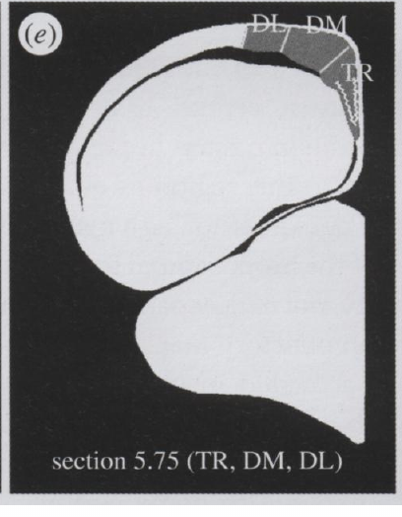
Odor experiments test distinct behavioral preparations
Path integration estimates displacement from information gathered during movement. It differs from a learned environmental map. Jorge and colleagues studied young pigeons 7–8 weeks old during displacement or simulated displacement, whereas Gagliardo and colleagues assessed complete homing tracks after odor treatments.
Jorge and colleagues compared natural odors, artificial odors and filtered air, including birds exposed at the home loft rather than transported. They measured activity-related labeling in the hippocampal formation, a forebrain region associated with spatial processing. The design connects odor exposure to the brain's spatial system.
The neural and behavioral studies address different endpoints and developmental conditions. Odor-dependent brain activation shows that smell engages the hippocampus, and the homing measures show how the flights unfold under the same odor conditions.
Jorge et al. (2014), Fig. 1e. Sampled subdivisions of the pigeon hippocampal formation.
Jorge et al. (2014); Gagliardo et al. (2011)
23
Notes:
• **Path integration** estimates displacement using information gathered during movement. It differs from a learned environmental map. Jorge and colleagues studied young pigeons 7–8 weeks old during displacement or simulated displacement, whereas Gagliardo and colleagues assessed complete homing tracks after odor treatments.
• Jorge and colleagues compared natural odors, artificial odors and filtered air, including birds exposed at the home loft rather than transported. They measured activity-related labeling in the **hippocampal formation**, a forebrain region associated with spatial processing.
• The neural and behavioral studies address different endpoints and developmental conditions. Odor-dependent brain activation can occur without establishing that artificial odors provide geographical information or restore the first-hour homing performance measured in the other preparation.
References:
Jorge PE, Phillips JB, Gonçalves A, Marques PAM, Němec P (2014). Odours stimulate neuronal activity in the dorsolateral area of the hippocampal formation during path integration. Proceedings of the Royal Society B 281(1783):20140025. https://doi.org/10.1098/rspb.2014.0025
Gagliardo A, Ioalè P, Filannino C, Wikelski M (2011). Homing pigeons only navigate in air with intact environmental odours: a test of the olfactory activation hypothesis with GPS data loggers. PLOS ONE 6(8):e22385. https://doi.org/10.1371/journal.pone.0022385
Figure: Jorge et al. (2014), Fig. 1e. Sampled subdivisions of the pigeon hippocampal formation.
Figure source: https://doi.org/10.1098/rspb.2014.0025

Slide 31
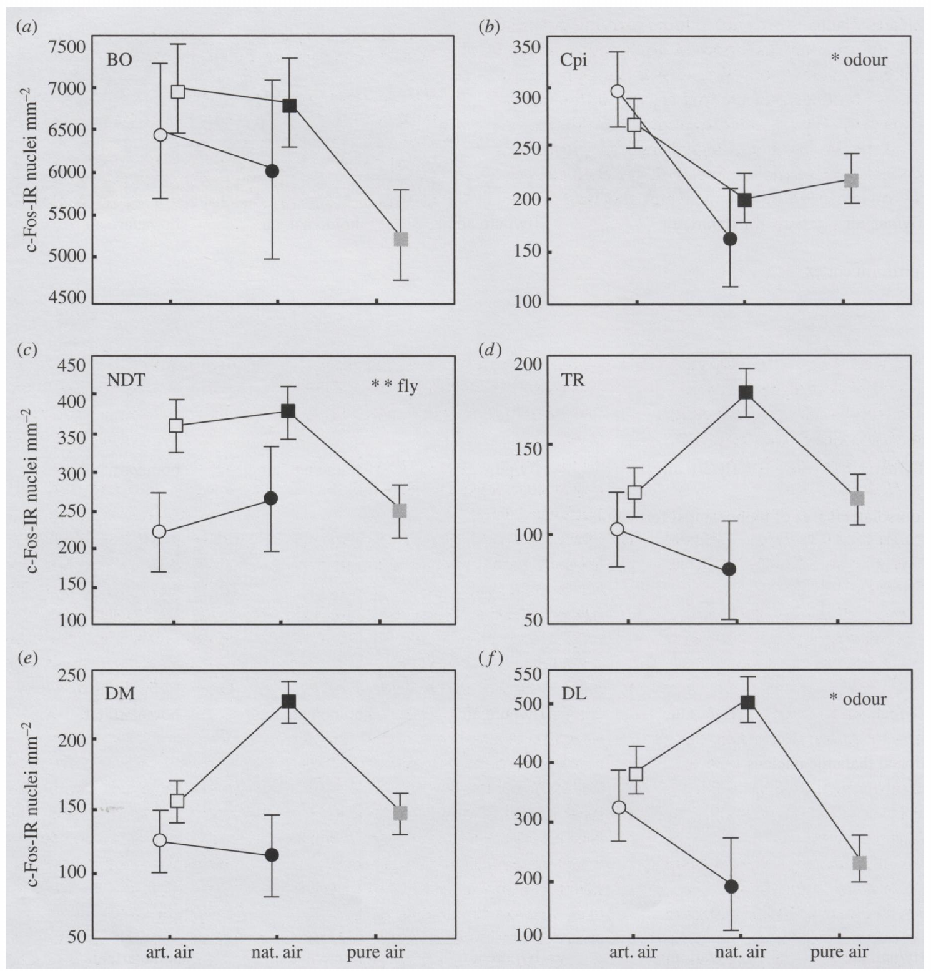
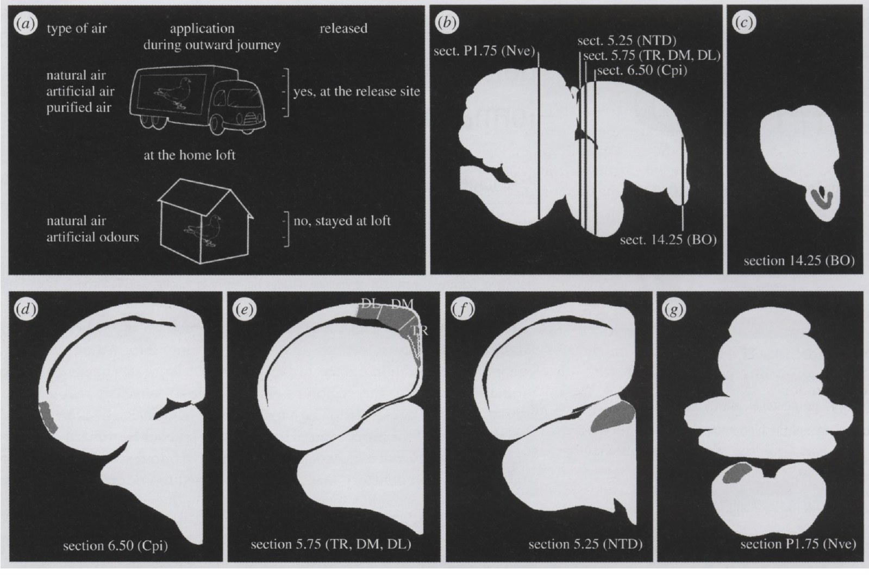
c-Fos labeling measures accumulated neuronal activation
c-Fos is an activity-related gene product whose expression marks recent neuronal activation. Immunoreactive nuclei are cells detected by antibody labeling, and their density gives a regional index that accumulates over time. The method records how much a region was engaged rather than the firing of individual action potentials.
Jorge and colleagues collected pigeon brains 1–2 h after the odor manipulation and compared c-Fos-labeled nuclei per square millimetre. The sampled regions included the hippocampal formation, olfactory bulb and piriform cortex, with separate odor and flight conditions. Each condition is therefore compared against its own control tissue.
The labeling links the exposure history to a regional response. It identifies a region whose activity follows the exposure, and the expression reflects cellular signaling that unfolds over the hours after the manipulation. The count reflects the activity of the whole region, so each condition is judged by its regional pattern.
Jorge et al. (2014), Fig. 1a–g. Treatment conditions and sampled forebrain and vestibular anatomy.
Jorge et al. (2014), Fig. 3a–f. Regional c-Fos activation after odor and flight treatments.
Jorge et al. (2014)
24
Notes:
• **c-Fos** is an activity-related gene product whose expression can mark recent neuronal activation. Immunoreactive nuclei are cells detected by antibody labeling. Their density provides a regional index accumulated over time, rather than an instantaneous record of action potentials.
• Jorge and colleagues collected pigeon brains 1–2 h after odor manipulation and compared c-Fos-labeled nuclei per square millimetre. The sampled regions included the hippocampal formation, olfactory bulb and piriform cortex, with separate odor and flight conditions.
• The measurement links exposure history to a regional response, but does not identify a neuron encoding home direction. Expression depends on cellular signaling and timing; these data do not specify a neurotransmitter, receptor subtype or ion channel responsible for the navigation-related effect.
References:
Jorge PE, Phillips JB, Gonçalves A, Marques PAM, Němec P (2014). Odours stimulate neuronal activity in the dorsolateral area of the hippocampal formation during path integration. Proceedings of the Royal Society B 281(1783):20140025. https://doi.org/10.1098/rspb.2014.0025
Figure: Jorge et al. (2014), Fig. 3a–f. Regional c-Fos activation after odor and flight treatments.
Figure source: https://doi.org/10.1098/rspb.2014.0025
Figure: Jorge et al. (2014), Fig. 1a–g. Treatment conditions and sampled forebrain and vestibular anatomy.
Figure source: https://doi.org/10.1098/rspb.2014.0025

Slide 32
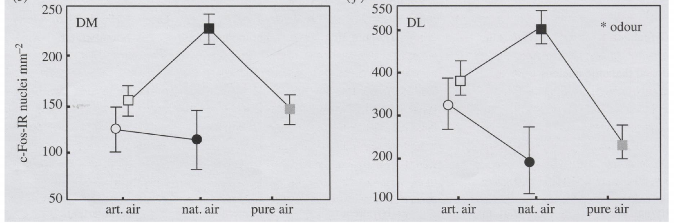
Non-home odors activate dorsolateral hippocampal tissue
The dorsolateral hippocampal area is one subdivision of the pigeon hippocampal formation, distinct from its dorsomedial and triangular subdivisions. Jorge and colleagues measured c-Fos labeling separately in these regions, so each subdivision contributes its own response to the comparison.
Natural odors during displacement and unfamiliar artificial odors increased dorsolateral activation relative to filtered air. Artificial odor exposure at the home loft produced activation comparable to exposure during displacement. The response was quantified as labeled nuclei per square millimetre.
The pattern points to an effect of non-home odor exposure rather than a response that depends only on geographical displacement. The authors proposed that the activation feeds navigation-related processing, and the labeling shows the dorsolateral tissue responding to the odors.
Jorge et al. (2014), Fig. 3e–f. Dorsomedial and dorsolateral hippocampal activation.
Jorge et al. (2014), Fig. 1a–g. Treatment conditions and sampled forebrain and vestibular anatomy.
Jorge et al. (2014)
25
Notes:
• The **dorsolateral hippocampal area** is one subdivision of the pigeon hippocampal formation, distinct from its dorsomedial and triangular subdivisions. Jorge and colleagues measured c-Fos labeling separately in these regions to avoid treating the forebrain response as spatially uniform.
• Natural odors during displacement and unfamiliar artificial odors increased dorsolateral activation relative to filtered air. Artificial odor exposure at the home loft also produced activation comparable to exposure during displacement. The response was quantified as labeled nuclei per square millimetre.
• This pattern supports an effect of non-home odor exposure rather than a response uniquely dependent on geographical displacement. The authors proposed activation of navigation-related processing, but the labeling does not establish that the dorsolateral tissue computes a complete location estimate.
References:
Jorge PE, Phillips JB, Gonçalves A, Marques PAM, Němec P (2014). Odours stimulate neuronal activity in the dorsolateral area of the hippocampal formation during path integration. Proceedings of the Royal Society B 281(1783):20140025. https://doi.org/10.1098/rspb.2014.0025
Figure: Jorge et al. (2014), Fig. 3e–f. Dorsomedial and dorsolateral hippocampal activation.
Figure source: https://doi.org/10.1098/rspb.2014.0025
Figure: Jorge et al. (2014), Fig. 1a–g. Treatment conditions and sampled forebrain and vestibular anatomy.
Figure source: https://doi.org/10.1098/rspb.2014.0025

Slide 33
c-Fos maps regional activity, not single neurons
c-Fos is an activity-related protein whose presence marks cells that recently fired. Antibody labeling reveals the labeled nuclei, and their density in a region shows how strongly that region was engaged over the hours before sampling. The measure summarizes activity across a region instead of recording the spikes of single cells.
Jorge and colleagues sampled brains 1–2 h after each odor treatment and counted labeled nuclei per square millimetre in the hippocampal formation, olfactory bulb and piriform cortex. Each condition was compared against controls processed the same way. The counts show which regions responded to each treatment.
A regional count shows where activity accumulated across the sampled tissue. The dorsolateral hippocampal area stands out because its labeling tracked the odor treatments most closely, which tells the reader where the response was strongest.
Jorge et al. (2014), Fig. 3e–f. Dorsomedial and dorsolateral hippocampal activation.
Jorge et al. (2014), Fig. 1a–g. Treatment conditions and sampled forebrain and vestibular anatomy.
Jorge et al. (2014)
25a
Notes:
• c-Fos is a regional index of recent activity.
• Marker.
– c-Fos marks cells that recently fired.
– Labeled nuclei are detected with an antibody.
• Density.
– Labeled nuclei were counted per square millimetre.
– The density gives a regional value.
• Timing.
– Brains were sampled 1–2 h after each treatment.
– The label reflects activity over that window.
• Regions.
– The hippocampal formation, olfactory bulb and piriform cortex were sampled.
– Each region gives its own count.
• Controls.
– Each condition was compared against matched controls.
– Differences reflect the treatment.
• Result.
– The dorsolateral hippocampal area responded most to the odors.
– The regional pattern shows where the activity was strongest.
• Source values.
– The published tracks and the measured values come from the original paper.
– Each value is reported with the scale used in the source.
• Why the measure matters.
– The result separates the bird's measured behavior from the mechanism that produces it.
– The comparison stays within the same birds or sites.
References:
Jorge PE, Phillips JB, Gonçalves A, Marques PAM, Němec P (2014). Odours stimulate neuronal activity in the dorsolateral area of the hippocampal formation during path integration. Proceedings of the Royal Society B 281(1783):20140025. https://doi.org/10.1098/rspb.2014.0025

Slide 34
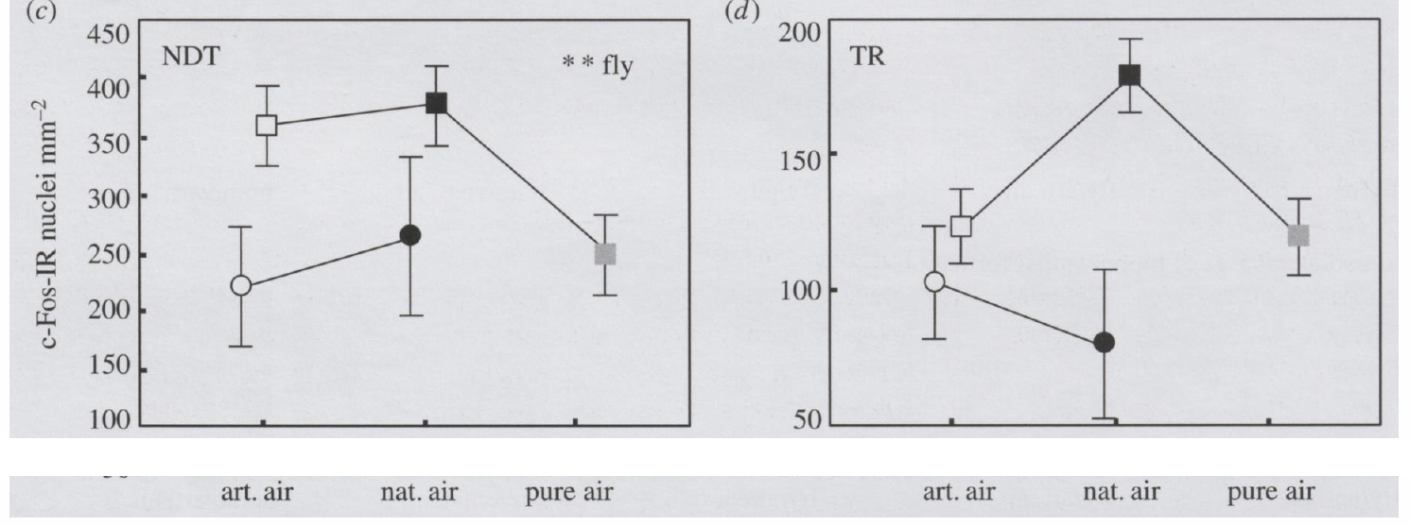
Flight and odor exposure have region-specific effects
The dorsal thalamic nucleus is a brain region that receives inputs relevant to sensory integration. Jorge and colleagues compared this region with subdivisions of the hippocampal formation, using displacement and simulated displacement to separate movement history from odor treatment.
Dorsal thalamic c-Fos labeling rose in birds that experienced displacement and homing flight. The hippocampal subdivisions did not all follow the same pattern, and the dorsolateral response was especially tied to odor exposure. Activity was measured as nuclei per square millimetre.
The regional differences oppose an account based only on uniform whole-brain arousal. Each region responds to a different combination of flight and odor, so the brain's response depends on the specific experience. The pattern shows that the regional response depends on the combination of flight and odor, and not on either factor alone.
Jorge et al. (2014), Fig. 3c–d. Dorsal thalamic and triangular hippocampal activation.
Jorge et al. (2014), Fig. 1a–g. Treatment conditions and sampled forebrain and vestibular anatomy.
Jorge et al. (2014)
26
Notes:
• The **dorsal thalamic nucleus** is a brain region receiving inputs relevant to sensory integration. Jorge and colleagues compared this region with subdivisions of the hippocampal formation, using displacement and simulated displacement to separate movement history from odor treatment.
• Dorsal thalamic c-Fos labeling increased in birds that experienced displacement and homing flight. Hippocampal subdivisions did not all follow the same response pattern, and the dorsolateral response was particularly associated with odor exposure. Activity was measured as nuclei per square millimetre.
• Regional differences oppose an account based solely on uniform whole-brain arousal. Nevertheless, activity-related labeling cannot establish the direction of information flow or prove a causal connection between thalamic activation and the hippocampal response.
References:
Jorge PE, Phillips JB, Gonçalves A, Marques PAM, Němec P (2014). Odours stimulate neuronal activity in the dorsolateral area of the hippocampal formation during path integration. Proceedings of the Royal Society B 281(1783):20140025. https://doi.org/10.1098/rspb.2014.0025
Figure: Jorge et al. (2014), Fig. 3c–d. Dorsal thalamic and triangular hippocampal activation.
Figure source: https://doi.org/10.1098/rspb.2014.0025
Figure: Jorge et al. (2014), Fig. 1a–g. Treatment conditions and sampled forebrain and vestibular anatomy.
Figure source: https://doi.org/10.1098/rspb.2014.0025

Slide 35
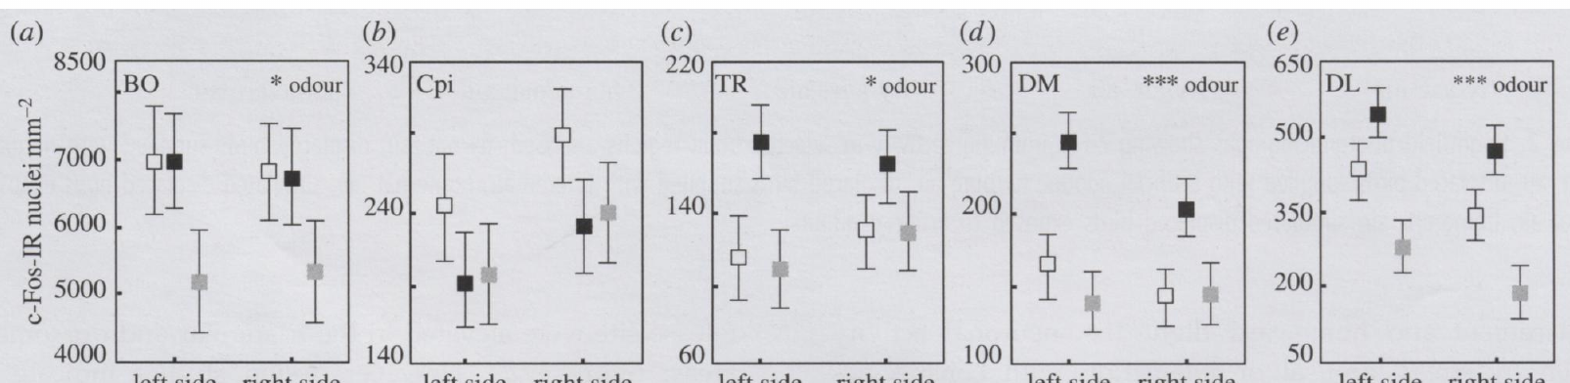
Lateralized activity does not prove a unique odor map
Lateralization is a difference in function or activity between the left and right sides of the brain. Jorge and colleagues counted c-Fos-labeled nuclei separately in each hemisphere after odor exposure and homing, rather than pooling bilateral tissue.
Olfactory treatments changed the hemispheric pattern in the olfactory bulb, piriform cortex and hippocampal subdivisions. The dorsolateral and dorsomedial hippocampal responses were consistent with a greater contribution of left-sided tissue to aspects of processing under the tested conditions.
The density measurements, expressed per square millimetre, show anatomical specificity in the left–right pattern. Regional expression is an indirect measure, and the pattern shows which side responded more under each odor condition.
Jorge et al. (2014), Fig. 4a–e. Left and right forebrain activation in birds that flew home.
Jorge et al. (2014), Fig. 1a–g. Treatment conditions and sampled forebrain and vestibular anatomy.
Jorge et al. (2014)
27
Notes:
• **Lateralization** is a difference in function or activity between the left and right sides of the brain. Jorge and colleagues counted c-Fos-labeled nuclei separately in each hemisphere after odor exposure and homing rather than pooling bilateral tissue.
• Olfactory treatments affected the hemispheric pattern in the olfactory bulb, piriform cortex and hippocampal subdivisions. Dorsolateral and dorsomedial hippocampal responses were consistent with a greater contribution of left-sided tissue to aspects of processing under the tested conditions.
• These density measurements, expressed per square millimetre, support anatomical specificity. They do not prove that one hemisphere contains the olfactory map or that odor activation alone restores successful navigation; regional expression remains an indirect endpoint with multiple possible functional interpretations.
References:
Jorge PE, Phillips JB, Gonçalves A, Marques PAM, Němec P (2014). Odours stimulate neuronal activity in the dorsolateral area of the hippocampal formation during path integration. Proceedings of the Royal Society B 281(1783):20140025. https://doi.org/10.1098/rspb.2014.0025
Figure: Jorge et al. (2014), Fig. 4a–e. Left and right forebrain activation in birds that flew home.
Figure source: https://doi.org/10.1098/rspb.2014.0025
Figure: Jorge et al. (2014), Fig. 1a–g. Treatment conditions and sampled forebrain and vestibular anatomy.
Figure source: https://doi.org/10.1098/rspb.2014.0025

Slide 36
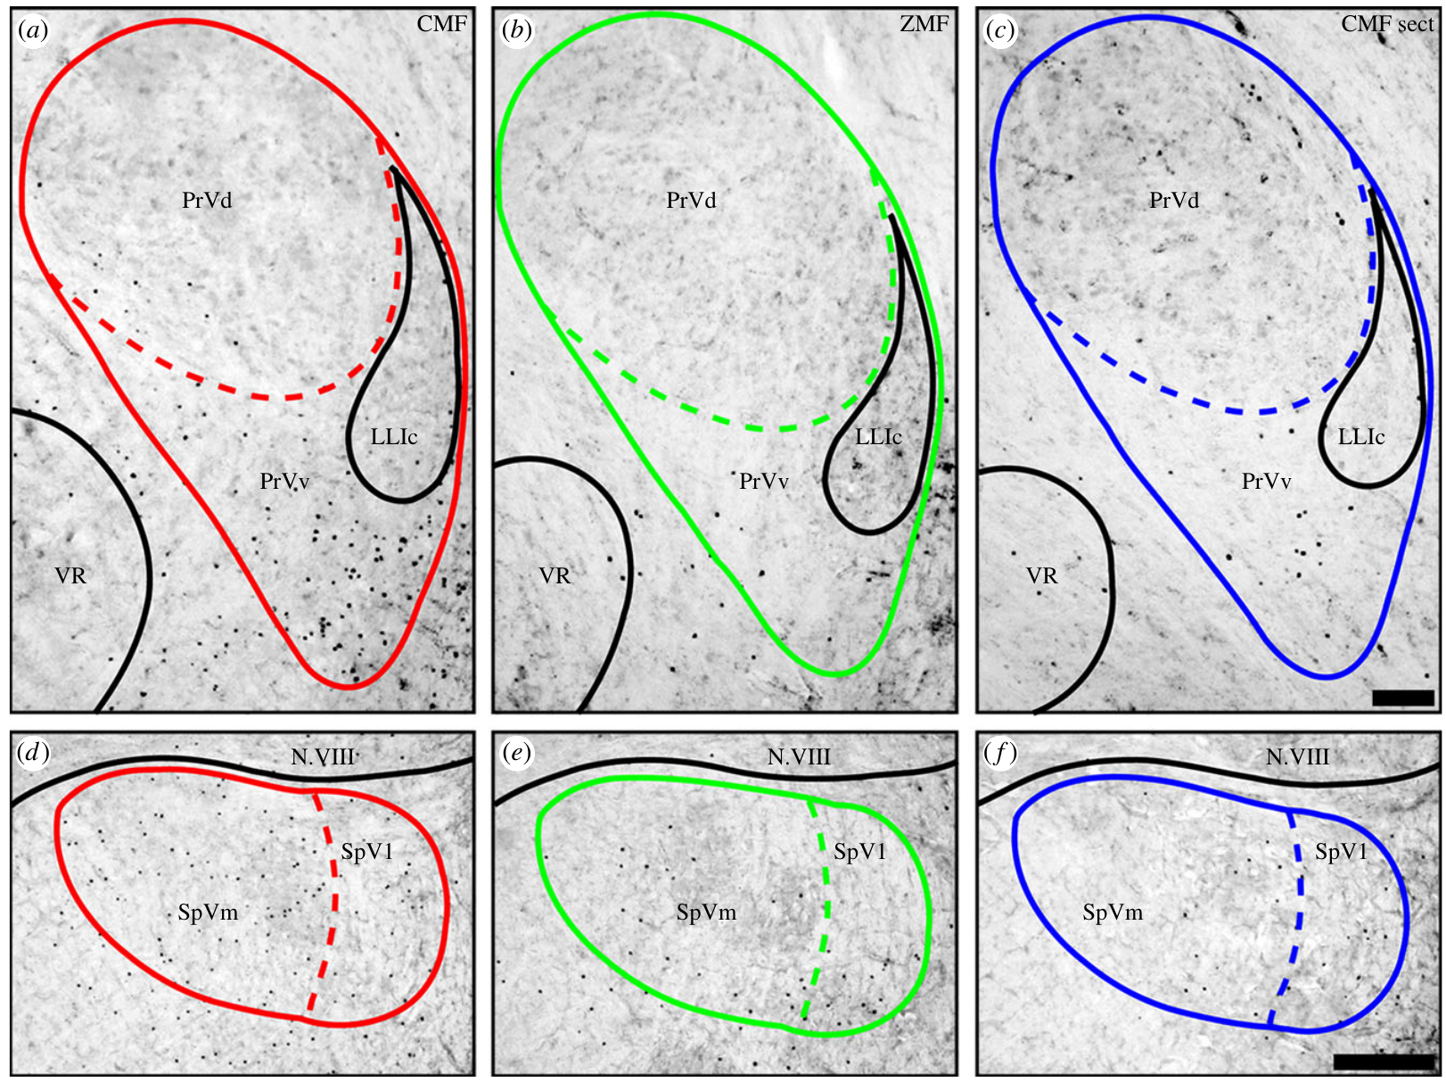
Magnetic stimulation recruits trigeminal brain regions
The trigeminal nerve carries sensory information from the head. Its ophthalmic branch, V1, projects to brainstem trigeminal nuclei. Lefeldt and colleagues asked whether changing magnetic fields activated these receiving regions in pigeons.
Birds experienced a constantly changing magnetic field, a compensated zero field, or the changing field after bilateral V1 section. Exposure lasted 3 h. ZENK, an activity-related gene product, was detected in the principal and spinal trigeminal nuclei, so the labeling marks where the input arrived.
The changing field raised regional labeling when V1 was intact, while removing the field and cutting the nerve reduced it. The response links magnetic stimulation to a peripheral afferent pathway, and the change in labeling follows the presence of both the field and the nerve.
Lefeldt et al. (2014), Fig. 1a–f. ZENK labeling after magnetic stimulation and nerve section.
Lefeldt et al. (2014)
28
Notes:
• The **trigeminal nerve** carries sensory information from the head. Its **ophthalmic branch**, designated V1, projects to brainstem trigeminal nuclei. Lefeldt and colleagues asked whether changing magnetic fields activated these receiving regions in pigeons.
• Birds experienced a constantly changing magnetic field, a compensated zero field, or the changing field after bilateral V1 section. Exposure lasted 3 h. **ZENK**, an activity-related gene product, was detected in the principal and spinal trigeminal nuclei.
• Changing-field exposure increased regional labeling when V1 was intact, while field removal and nerve section reduced it. The evidence links magnetic stimulation to a peripheral afferent pathway, but does not identify the receptor cell or establish successful magnetic navigation in the arena.
References:
Lefeldt N, Heyers D, Schneider NL, Engels S, Elbers D, Mouritsen H (2014). Magnetic field-driven induction of ZENK in the trigeminal system of pigeons (Columba livia). Journal of the Royal Society Interface 11(100):20140777. https://doi.org/10.1098/rsif.2014.0777
Figure: Lefeldt et al. (2014), Fig. 1a–f. ZENK labeling after magnetic stimulation and nerve section.
Figure source: https://doi.org/10.1098/rsif.2014.0777

Slide 37
Magnetic stimulation labels trigeminal nuclei
The trigeminal nerve carries sensory information from the head to brainstem nuclei. Its ophthalmic branch, V1, sends fibers to the principal and spinal trigeminal nuclei. Lefeldt and colleagues used ZENK labeling to ask whether changing magnetic fields activated these nuclei in pigeons.
Pigeons were exposed for 3 h to a constantly changing magnetic field, to a compensated zero field, or to the changing field after bilateral V1 section. ZENK was detected in the principal and spinal trigeminal nuclei after each exposure. The pattern of labeling across the three groups shows where the changing field had its effect.
Labeling rose when the field changed and V1 was intact, and it fell when the field was removed or the nerve was cut. The result links the magnetic stimulus to the peripheral sensory pathway that runs through V1. The labeling pattern therefore identifies which nuclei the changing field reached.
Lefeldt et al. (2014), Fig. 1a–f. ZENK labeling after magnetic stimulation and nerve section.
Lefeldt et al. (2014)
28a
Notes:
• Trigeminal labeling depends on both the field and the nerve.
• Nerve.
– V1 is the ophthalmic branch of the trigeminal nerve.
– It carries sensory input from the head.
• Nuclei.
– The principal and spinal trigeminal nuclei receive V1 input.
– ZENK marks them after exposure.
• Exposure.
– Birds spent 3 h in one of three magnetic conditions.
– The conditions were changing, zero, and changing with V1 section.
• Pattern.
– Labeling was highest with an intact nerve and a changing field.
– Removing either reduced it.
• Controls.
– The zero-field condition removes the changing stimulus.
– V1 section removes the nerve input.
• Link.
– The result connects magnetic stimulation to a peripheral pathway.
– The pathway runs through V1.
• Source values.
– The published tracks and the measured values come from the original paper.
– Each value is reported with the scale used in the source.
• Why the measure matters.
– The result separates the bird's measured behavior from the mechanism that produces it.
– The comparison stays within the same birds or sites.
References:
Lefeldt N, Heyers D, Schneider NL, Engels S, Elbers D, Mouritsen H (2014). Magnetic field-driven induction of ZENK in the trigeminal system of pigeons (Columba livia). Journal of the Royal Society Interface 11(100):20140777. https://doi.org/10.1098/rsif.2014.0777

Slide 38
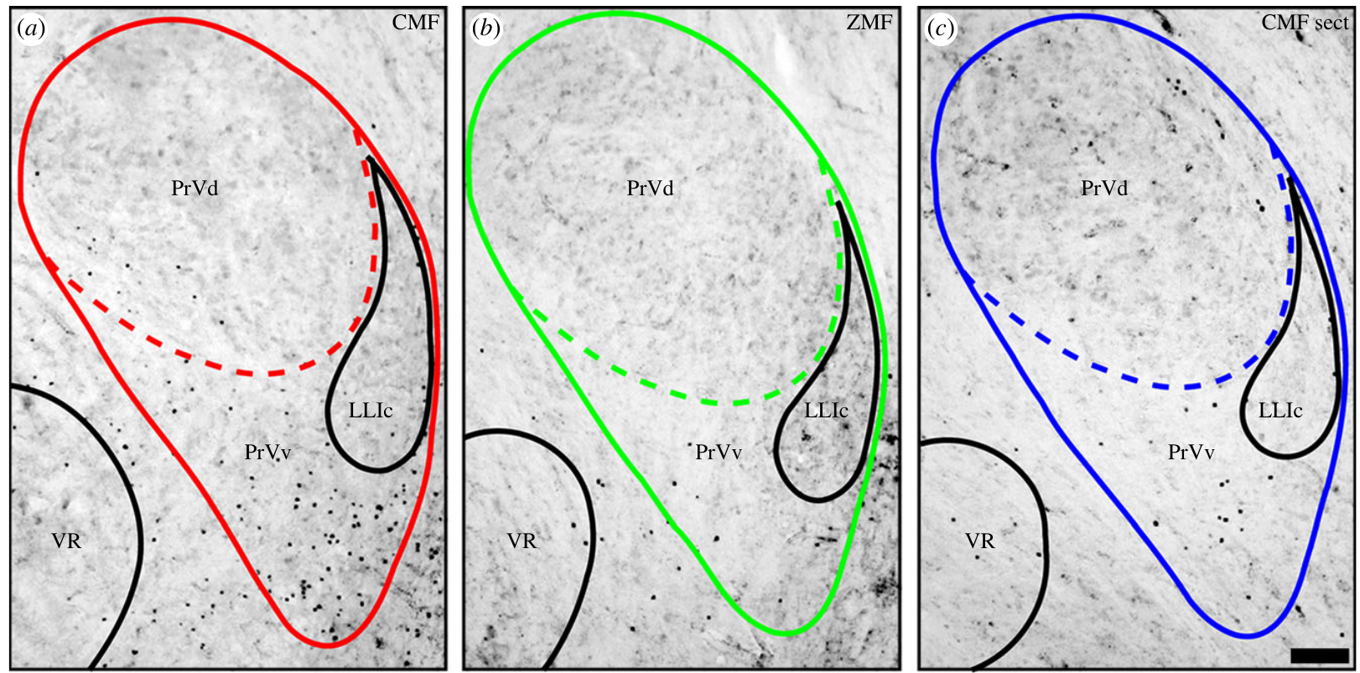
The principal trigeminal response is anatomically selective
The principal sensory nucleus of the trigeminal nerve, PrV, receives ascending sensory input from the head. Its ventral region, PrVv, is distinguished from the dorsal region using the brainstem anatomy preserved in the source sections, so the response can be located precisely.
After 3 h of changing magnetic fields, Lefeldt and colleagues found ZENK labeling concentrated in a crescent-shaped ventral region. Zero-field exposure and bilateral V1 section both reduced the response. The original micrographs carry a 100 µm scale bar.
The concentrated labeling matches a specific receiving region rather than uniform activation of every PrV neuron. ZENK marks activity over the exposure period, which points to the ventral region as the site where the field-related input is registered.
Lefeldt et al. (2014), Fig. 1a–c. Principal trigeminal nucleus activation across treatments.
Lefeldt et al. (2014)
29
Notes:
• The **principal sensory nucleus of the trigeminal nerve**, abbreviated PrV, receives ascending sensory input from the head. Its ventral region, PrVv, can be distinguished from the dorsal region using the brainstem anatomy preserved in the source sections.
• After 3 h of changing magnetic fields, Lefeldt and colleagues found ZENK labeling concentrated in a crescent-shaped ventral region. Zero-field exposure and bilateral V1 section reduced the response. The original micrographs retain a 100 µm scale bar.
• Spatial concentration is consistent with a specific receiving region rather than uniform activation of every PrV neuron. ZENK labeling does not measure the firing rate of those cells, establish their magnetic tuning or identify whether the input encodes direction, intensity or another field property.
References:
Lefeldt N, Heyers D, Schneider NL, Engels S, Elbers D, Mouritsen H (2014). Magnetic field-driven induction of ZENK in the trigeminal system of pigeons (Columba livia). Journal of the Royal Society Interface 11(100):20140777. https://doi.org/10.1098/rsif.2014.0777
Figure: Lefeldt et al. (2014), Fig. 1a–c. Principal trigeminal nucleus activation across treatments.
Figure source: https://doi.org/10.1098/rsif.2014.0777

Slide 39
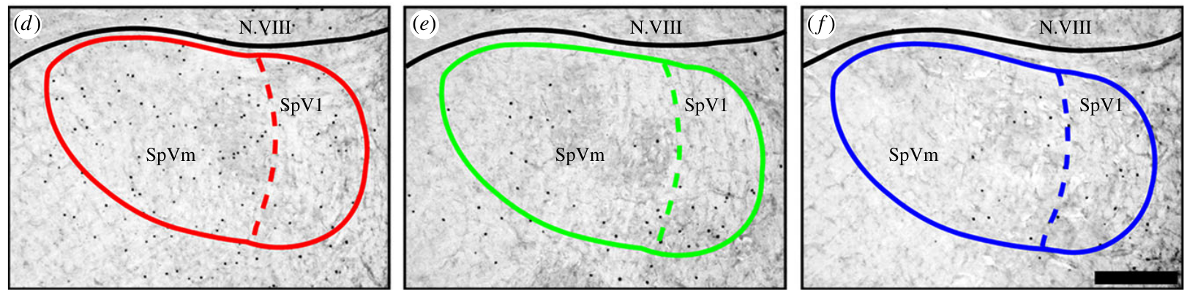
Spinal trigeminal activation requires intact afferents
The spinal trigeminal nucleus, SpV, receives descending trigeminal sensory input. Lefeldt and colleagues distinguished medial and lateral subdivisions, so the magnetic response could be localized rather than assigned to one undifferentiated brainstem region.
The medial subdivision showed the strongest increase under changing magnetic fields, and bilateral V1 section reduced activation. The source sections compare changing-field, zero-field and sectioned conditions directly, with a 200 µm scale bar for the spinal nucleus.
The loss after section supports a contribution from information carried by V1. The labeling shows that the activated cells depend on intact afferents, which links the spinal response to the nerve. The loss of labeling after section shows how much of the response depends on the nerve.
Lefeldt et al. (2014), Fig. 1d–f. Spinal trigeminal nucleus activation across treatments.
Lefeldt et al. (2014)
30
Notes:
• The **spinal trigeminal nucleus**, or SpV, receives descending trigeminal sensory input. Lefeldt and colleagues distinguished medial and lateral subdivisions, allowing the magnetic response to be localized rather than assigning all labeled cells to one undifferentiated brainstem region.
• The medial subdivision showed the strongest increase under changing magnetic fields, and bilateral V1 section reduced activation. Source sections compare changing-field, zero-field and sectioned conditions directly, with a 200 µm scale bar for the spinal nucleus.
• The loss after section supports a contribution from V1-transmitted information. It does not establish that the activated SpV cells form a magnetic map or that they are sufficient for choosing a homeward course; the experiment measured labeling without a homing task.
References:
Lefeldt N, Heyers D, Schneider NL, Engels S, Elbers D, Mouritsen H (2014). Magnetic field-driven induction of ZENK in the trigeminal system of pigeons (Columba livia). Journal of the Royal Society Interface 11(100):20140777. https://doi.org/10.1098/rsif.2014.0777
Figure: Lefeldt et al. (2014), Fig. 1d–f. Spinal trigeminal nucleus activation across treatments.
Figure source: https://doi.org/10.1098/rsif.2014.0777

Slide 40
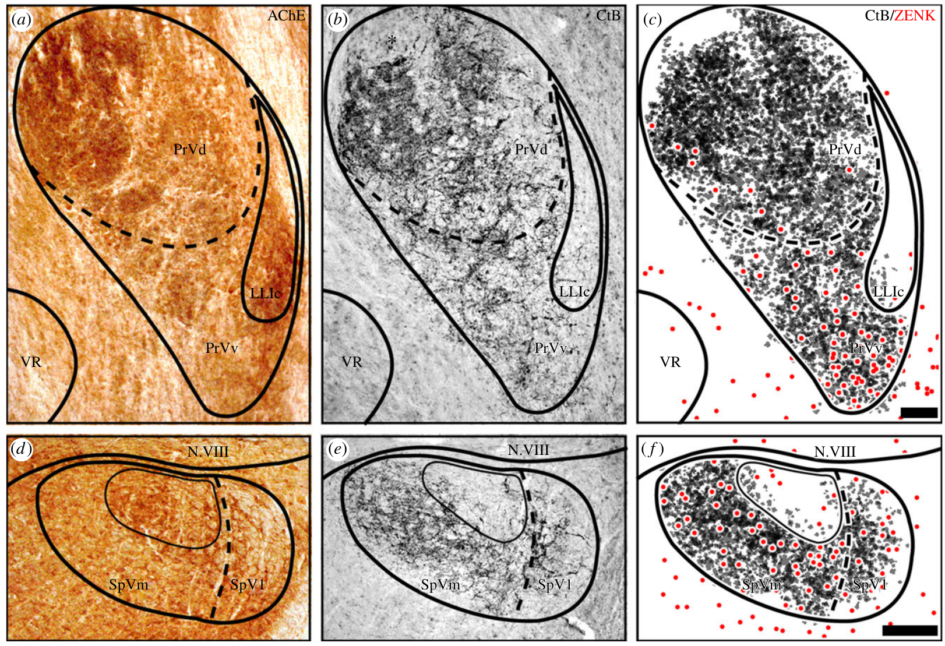
Anatomical tracing links afferents with activated regions
Neuronal tracing labels the anatomical pathways that leave an injection site. Lefeldt and colleagues introduced cholera toxin B into V1 to identify its central projections, then compared the labeled afferents with the regions that contained ZENK-positive neurons after magnetic stimulation.
V1 fibers terminated in the principal and spinal trigeminal nuclei. The published overlays keep the spatial relationship between the traced fibers and the activation, with 100 µm and 200 µm scales. Acetylcholinesterase staining supplied anatomical boundaries for locating the subdivisions.
The overlap shows a plausible route for peripheral signals to reach the responsive tissue. Acetylcholinesterase serves here as an anatomical marker for locating those boundaries, which places the pathway within known regions.
Lefeldt et al. (2014), Fig. 2a–f. Trigeminal anatomy, afferent tracing and ZENK labeling.
Lefeldt et al. (2014)
31
Notes:
• **Neuronal tracing** labels anatomical pathways from an injection site. Lefeldt and colleagues introduced cholera toxin B into V1 to identify its central projections, then compared labeled afferents with regions containing ZENK-positive neurons after magnetic stimulation.
• V1 fibers terminated in the principal and spinal trigeminal nuclei. The published overlays preserve the spatial relationship between traced fibers and activation, with 100 µm and 200 µm scales. Acetylcholinesterase staining supplied anatomical boundaries for locating the subdivisions.
• Regional overlap supports a plausible route for peripheral signals to reach the responsive tissue. It does not establish a functional synapse onto each labeled cell. Acetylcholinesterase used as an anatomical marker also does not prove that acetylcholine transmits the putative magnetic signal.
References:
Lefeldt N, Heyers D, Schneider NL, Engels S, Elbers D, Mouritsen H (2014). Magnetic field-driven induction of ZENK in the trigeminal system of pigeons (Columba livia). Journal of the Royal Society Interface 11(100):20140777. https://doi.org/10.1098/rsif.2014.0777
Figure: Lefeldt et al. (2014), Fig. 2a–f. Trigeminal anatomy, afferent tracing and ZENK labeling.
Figure source: https://doi.org/10.1098/rsif.2014.0777

Slide 41
Tracing shows a route from V1 to labeled nuclei
Neuronal tracing follows the anatomical pathways that leave an injection site. Lefeldt and colleagues injected cholera toxin B into V1 to label its central projections. The labeled fibers were then compared with the regions that showed ZENK after magnetic stimulation.
V1 fibers terminated in the principal and spinal trigeminal nuclei, which are the same nuclei that contained ZENK-positive cells. The overlays keep the position of each traced fiber relative to the activation, with scales of 100 µm and 200 µm. Acetylcholinesterase staining marked the nuclear boundaries, so the subdivisions could be located precisely.
The overlap places the magnetic response along a known route from the nerve to the brainstem. Acetylcholinesterase acts here as a marker of boundaries, which keeps the labeled tissue tied to the known anatomy. The labeled fibers and the activated nuclei are compared in the same sections, which keeps the spatial relation intact.
Lefeldt et al. (2014), Fig. 2a–f. Trigeminal anatomy, afferent tracing and ZENK labeling.
Lefeldt et al. (2014)
31a
Notes:
• Tracing links the nerve to the labeled brainstem.
• Injection.
– Cholera toxin B was injected into V1.
– It labels the central projections of V1.
• Overlap.
– The labeled fibers overlapped the ZENK-positive nuclei.
– The same nuclei received V1 input.
• Scale.
– The overlays carry 100 µm and 200 µm scale bars.
– Positions can be compared across sections.
• Boundaries.
– Acetylcholinesterase outlines the nuclei.
– Subdivisions are located from the stain.
• Route.
– The fibers link the nerve to the brainstem.
– The route runs from the periphery to the labeled tissue.
• Anatomy.
– The tracing keeps the response within known regions.
– Each step follows an anatomical pathway.
• Source values.
– The published tracks and the measured values come from the original paper.
– Each value is reported with the scale used in the source.
• Why the measure matters.
– The result separates the bird's measured behavior from the mechanism that produces it.
– The comparison stays within the same birds or sites.
References:
Lefeldt N, Heyers D, Schneider NL, Engels S, Elbers D, Mouritsen H (2014). Magnetic field-driven induction of ZENK in the trigeminal system of pigeons (Columba livia). Journal of the Royal Society Interface 11(100):20140777. https://doi.org/10.1098/rsif.2014.0777

Slide 42
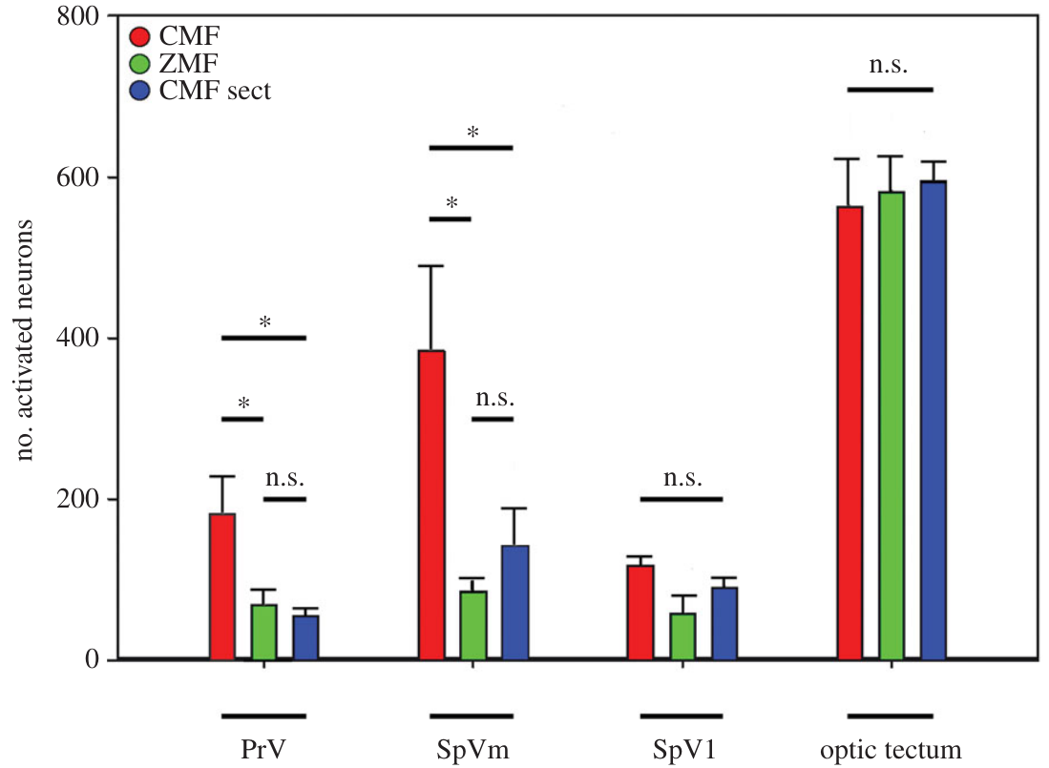
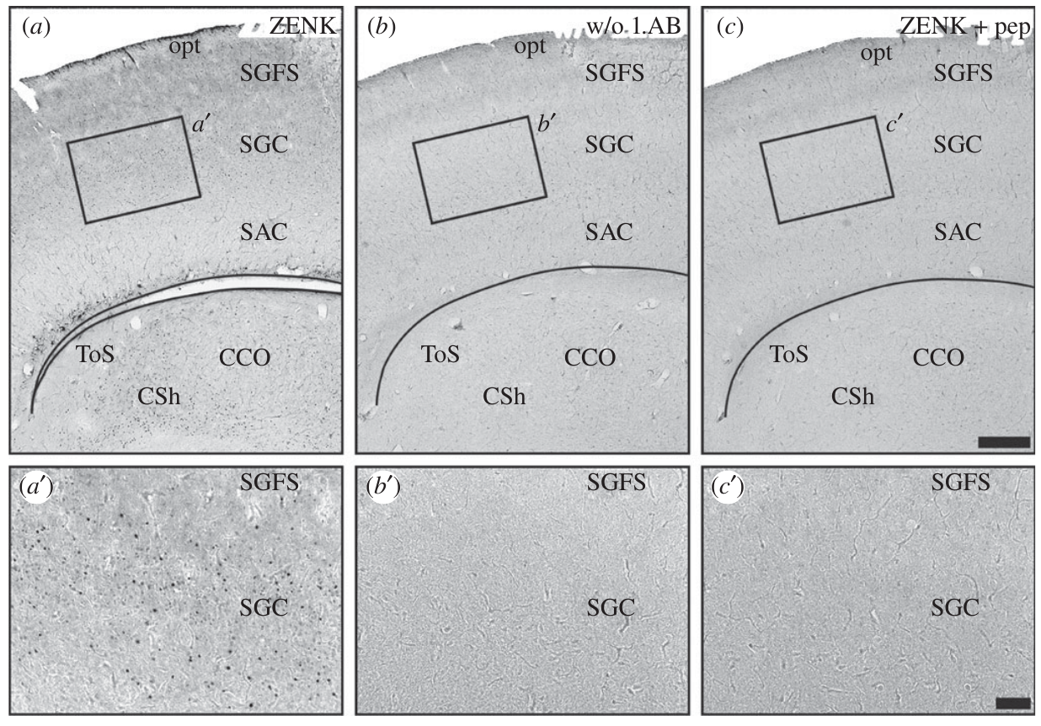
Nerve section and control regions constrain the response
A loss-of-function test interrupts a candidate pathway and measures the response that remains. Lefeldt and colleagues cut both V1 branches, then exposed the birds to the same changing magnetic stimulus used for intact animals.
Trigeminal activation decreased after section, whereas the optic tectum, a midbrain sensory region included as a comparison, did not differ appreciably among the magnetic conditions. Counts were collected after 3 h of exposure, with field and nerve manipulations compared separately.
The specificity argues against uniform activation of all measured brain regions. The unchanged tectal region shows that the sectioned nerve selectively removes the trigeminal response, so the trigeminal pathway is the one that carries the effect.
Lefeldt et al. (2014), Fig. 6a–c and enlargements. Optic tectum anatomy and antibody-staining controls.
Lefeldt et al. (2014), Fig. 3. Activation in trigeminal regions and the optic tectum.
Lefeldt et al. (2014)
32
Notes:
• A **loss-of-function test** interrupts a candidate pathway and measures the remaining response. Lefeldt and colleagues cut both V1 branches, then exposed the birds to the same changing magnetic stimulus used for intact animals.
• Trigeminal activation decreased after section, whereas the **optic tectum**, a midbrain sensory region included as a comparison, did not differ appreciably among the magnetic conditions. Counts were collected after 3 h of exposure, with field and nerve manipulations compared separately.
• This specificity argues against uniform activation of all measured brain regions. It does not establish the molecular transducer or the bird’s perceptual experience. The unchanged tectal control cannot rule out every other visual or magnetic pathway in the brain.
References:
Lefeldt N, Heyers D, Schneider NL, Engels S, Elbers D, Mouritsen H (2014). Magnetic field-driven induction of ZENK in the trigeminal system of pigeons (Columba livia). Journal of the Royal Society Interface 11(100):20140777. https://doi.org/10.1098/rsif.2014.0777
Figure: Lefeldt et al. (2014), Fig. 3. Activation in trigeminal regions and the optic tectum.
Figure source: https://doi.org/10.1098/rsif.2014.0777
Figure: Lefeldt et al. (2014), Fig. 6a–c and enlargements. Optic tectum anatomy and antibody-staining controls.
Figure source: https://doi.org/10.1098/rsif.2014.0777

Slide 43
Behavioral controls limit a mechanical explanation
V1 also carries ordinary mechanical information from the head, so pecking, grooming and contact with the cage could activate its receiving nuclei. A magnetic manipulation therefore needs behavioral controls before the increase in trigeminal labeling can be assigned to the field.
Lefeldt and colleagues monitored pigeons with infrared cameras during the 3 h exposure and quantified movement and beak contacts. The analysis found no systematic positive relationship that explains the regional ZENK increase as a result of more mechanical stimulation under the changing-field condition.
The controls reduce a contact-driven account, which points to the field as the source of the labeling. The experiment measured neural responsiveness rather than a navigational choice, so the response is evidence of field detection, separate from any compass behavior.
Lefeldt et al. (2014), Fig. 1a–f. ZENK labeling after magnetic stimulation and nerve section.
Lefeldt et al. (2014)
33
Notes:
• V1 also carries ordinary mechanical information from the head, so pecking, grooming and contact with the cage could activate its receiving nuclei. A magnetic manipulation requires behavioral controls before increased trigeminal labeling can be assigned to field-dependent input.
• Lefeldt and colleagues monitored pigeons with infrared cameras during the 3 h exposure and quantified movement and beak contacts. They found no systematic positive relationship explaining the regional ZENK increase as a consequence of more mechanical stimulation under the changing-field condition.
• The controls reduce a simple contact-driven account without identifying the sensory receptor. The experiment also supplied no stable navigational direction and did not ask the pigeons to orient; neural responsiveness must be distinguished from evidence for a behavioral compass or map.
References:
Lefeldt N, Heyers D, Schneider NL, Engels S, Elbers D, Mouritsen H (2014). Magnetic field-driven induction of ZENK in the trigeminal system of pigeons (Columba livia). Journal of the Royal Society Interface 11(100):20140777. https://doi.org/10.1098/rsif.2014.0777
Figure: Lefeldt et al. (2014), Fig. 1a–f. ZENK labeling after magnetic stimulation and nerve section.
Figure source: https://doi.org/10.1098/rsif.2014.0777

Slide 44
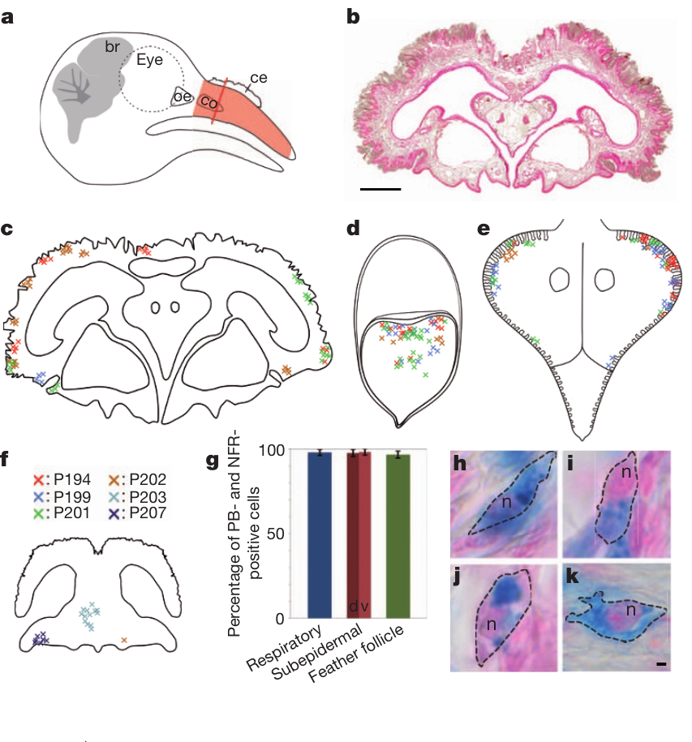
Iron-rich beak cells require independent identification
Magnetite is an iron oxide proposed as a material for magnetic sensory transduction. Finding iron in tissue identifies the iron, and a separate test is needed to identify the cell that holds it, because iron also occurs in metabolic storage and immune cells.
Treiber and colleagues stained pigeon upper beaks with Prussian blue, which detects ferric iron, and mapped the labeled cells through serial sections. Iron-rich cells occurred in respiratory epithelium, subepidermal tissue and feather follicles. The source preserves the anatomy of these distinct tissue locations.
The distribution shows that position and iron content are not enough to define a receptor. Prussian blue is a stain for iron rather than a selective test for magnetite or neurons, so additional cellular markers and ultrastructure were required to assign a sensory role.
Treiber et al. (2012), Fig. 1a–k. Anatomical distribution and nucleation of iron-rich beak cells.
Treiber et al. (2012)
34
Notes:
• **Magnetite** is an iron oxide proposed as a material for magnetic sensory transduction. Finding iron in tissue is insufficient to identify a magnetic receptor, because iron also occurs in metabolic storage and immune cells.
• Treiber and colleagues stained pigeon upper beaks with **Prussian blue**, which detects ferric iron, and mapped labeled cells through serial sections. Iron-rich cells occurred in respiratory epithelium, subepidermal tissue and feather follicles. The source preserves the anatomy of these distinct tissue locations.
• The observations challenge identification by position and iron content alone. Prussian blue is not a selective test for magnetite or neurons, so additional cellular markers and ultrastructure were needed before assigning a sensory function to the stained cells.
References:
Treiber CD, Salzer MC, Riegler J, Edelman N, Sugar C, Breuss M, Pichler P, Cadiou H, Saunders M, Lythgoe M, Shaw J, Keays DA (2012). Clusters of iron-rich cells in the upper beak of pigeons are macrophages not magnetosensitive neurons. Nature 484(7394):367–370. https://doi.org/10.1038/nature11046
Figure: Treiber et al. (2012), Fig. 1a–k. Anatomical distribution and nucleation of iron-rich beak cells.
Figure source: https://doi.org/10.1038/nature11046

Slide 45
Stains locate iron, not the cell that holds it
Prussian blue is a stain that reveals ferric iron in tissue. A stained spot shows where iron accumulates, and a second line of evidence is needed to name the cell that holds it, since iron also appears in metabolic storage and immune cells.
Treiber and colleagues stained pigeon upper beaks with Prussian blue and mapped the labeled cells through serial sections. The stained cells lay in respiratory epithelium, subepidermal tissue and feather follicles. The position of each labeled cell is therefore recorded alongside its tissue.
The stained positions give a map of where iron occurs, which is the first step toward identifying a magnetic receptor. Further markers and ultrastructure then decide whether the stained cells are sensory or storage cells. Each stained location is then examined for the cell type that carries it.
Treiber et al. (2012), Fig. 1a–k. Anatomical distribution and nucleation of iron-rich beak cells.
Treiber et al. (2012)
34a
Notes:
• Staining locates iron, and a cell is identified by more markers.
• Stain.
– Prussian blue detects ferric iron.
– A blue spot marks iron, not a cell type.
• Sections.
– Labeled cells were mapped through serial sections.
– Each cell has a recorded position.
• Tissues.
– Labeled cells lay in three tissue types.
– These tissues are distinct in the beak.
• Iron sources.
– Iron also appears in storage and immune cells.
– A stain alone cannot name the cell.
• Next step.
– Additional markers and ultrastructure identify the cell.
– Those tests decide the cell's role.
• Meaning.
– The stain gives the first map of iron positions.
– Identification follows from further tests.
• Source values.
– The published tracks and the measured values come from the original paper.
– Each value is reported with the scale used in the source.
• Why the measure matters.
– The result separates the bird's measured behavior from the mechanism that produces it.
– The comparison stays within the same birds or sites.
References:
Treiber CD, Salzer MC, Riegler J, Edelman N, Sugar C, Breuss M, Pichler P, Cadiou H, Saunders M, Lythgoe M, Shaw J, Keays DA (2012). Clusters of iron-rich cells in the upper beak of pigeons are macrophages not magnetosensitive neurons. Nature 484(7394):367–370. https://doi.org/10.1038/nature11046

Slide 46
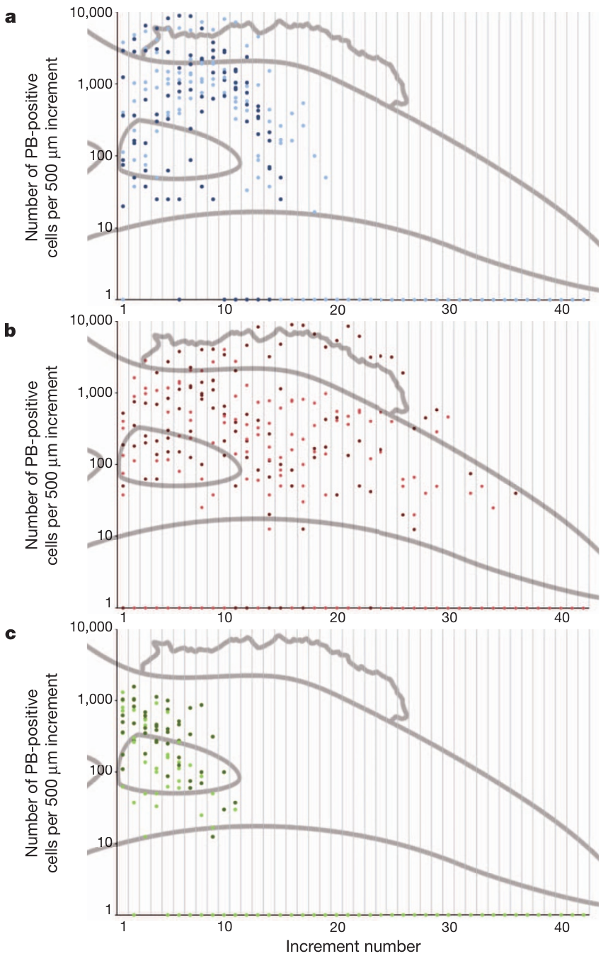
Iron-positive cells do not form a fixed bilateral array
A reproducible sensory organ should show an anatomical organization that matches its proposed function. Earlier descriptions assigned magnetoreception to six bilateral iron-rich clusters in the upper beak, a claim that required systematic examination across individuals.
Treiber and colleagues counted Prussian-blue-positive cells in successive 500 µm increments along the beak. Their locations and numbers varied widely among pigeons, and the cells were spread across several tissues rather than forming a consistent six-cluster arrangement.
The distribution does not match the proposed receptor array. The variation removes a central anatomical premise of that magnetic-receptor account, because the arrangement that the account relies on was not found. The variation across pigeons is therefore an observed property of the beak tissue, and it is documented in the individual counts.
Treiber et al. (2012), Fig. 2a–c. Variable distribution of iron-positive cells along the beak.
Treiber et al. (2012)
35
Notes:
• A reproducible sensory organ should have an anatomical organization consistent with its proposed function. Earlier descriptions had assigned magnetoreception to six bilateral iron-rich clusters in the upper beak, but that claim required systematic examination across individuals.
• Treiber and colleagues counted Prussian-blue-positive cells in successive 500 µm increments along the beak. Their locations and numbers varied widely among pigeons, with cells distributed through multiple tissues rather than a consistent six-cluster arrangement.
• The distribution does not fit the claimed stereotyped receptor array. Variation alone cannot exclude every possible sensory cell elsewhere in the beak, but it removes a central anatomical premise of that specific magnetic-receptor account.
References:
Treiber CD, Salzer MC, Riegler J, Edelman N, Sugar C, Breuss M, Pichler P, Cadiou H, Saunders M, Lythgoe M, Shaw J, Keays DA (2012). Clusters of iron-rich cells in the upper beak of pigeons are macrophages not magnetosensitive neurons. Nature 484(7394):367–370. https://doi.org/10.1038/nature11046
Figure: Treiber et al. (2012), Fig. 2a–c. Variable distribution of iron-positive cells along the beak.
Figure source: https://doi.org/10.1038/nature11046

Slide 47
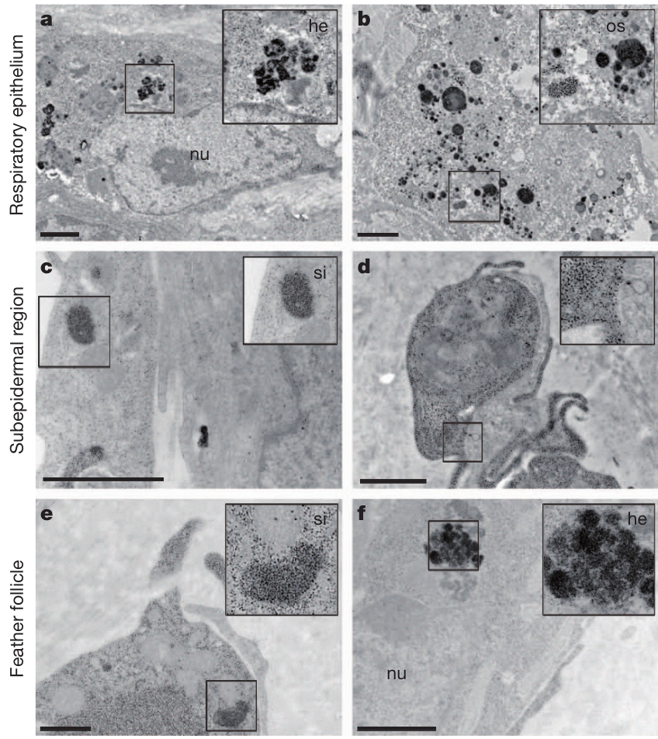
Ultrastructure identifies iron-storage compartments
Ultrastructure is cellular organization resolved with electron microscopy. Treiber and colleagues examined the iron-rich beak cells in three tissue compartments, rather than assuming that their blue staining indicated sensory dendrites. The electron microscope shows what the cells contain.
The cells contained ferritin-like granules 6–9 nm in diameter, haemosiderin, an aggregated iron-storage material, and membrane-bound compartments with iron, termed siderosomes. The source micrographs carry 1 µm scale bars and show the labeled cellular structures.
These features match cellular iron storage rather than a specialized magnetite receptor. The electron microscopy and material analyses found no sensory magnetite organization in the sampled cells, and the result describes those cells in particular.
Treiber et al. (2012), Fig. 3a–f. Ultrastructure of iron-rich cells in three beak tissues.
Treiber et al. (2012)
36
Notes:
• **Ultrastructure** is cellular organization resolved with electron microscopy. Treiber and colleagues examined iron-rich beak cells in three tissue compartments rather than assuming that their blue staining indicated sensory dendrites.
• Cells contained ferritin-like granules 6–9 nm in diameter, **haemosiderin**, an aggregated iron-storage material, and membrane-bound iron-containing compartments termed **siderosomes**. The source micrographs retain 1 µm scale bars and the labeled cellular structures.
• These features are consistent with cellular iron storage rather than the proposed specialized magnetite receptor. Electron microscopy and material analyses did not identify the claimed sensory magnetite organization, but this negative result concerns the sampled iron-rich cells, not every possible magnetic transduction mechanism.
References:
Treiber CD, Salzer MC, Riegler J, Edelman N, Sugar C, Breuss M, Pichler P, Cadiou H, Saunders M, Lythgoe M, Shaw J, Keays DA (2012). Clusters of iron-rich cells in the upper beak of pigeons are macrophages not magnetosensitive neurons. Nature 484(7394):367–370. https://doi.org/10.1038/nature11046
Figure: Treiber et al. (2012), Fig. 3a–f. Ultrastructure of iron-rich cells in three beak tissues.
Figure source: https://doi.org/10.1038/nature11046

Slide 48
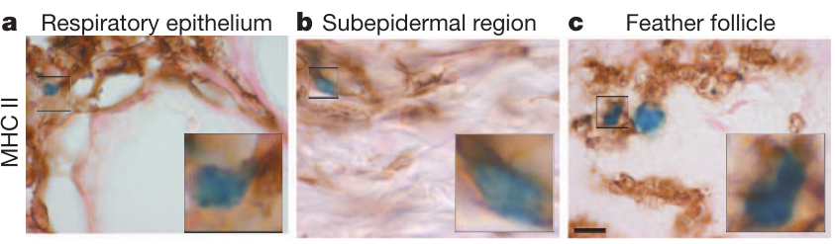
Immune labeling identifies macrophages in beak tissue
Macrophages are immune cells that engulf material and take part in tissue defense. MHC II is a cell-surface antigen-presentation marker expressed by several immune cell types. Treiber and colleagues combined this marker with iron staining to determine the identity of the beak cells.
MHC II labeling colocalized with iron-positive cells in respiratory epithelium, subepidermal tissue and feather follicles. Together with the ultrastructure and the absence of convincing neuronal-marker labeling, these findings support macrophages rather than magnetosensitive neurons. The micrographs preserve a 10 µm scale.
Cell identity matters because iron accumulation in a macrophage does not by itself transduce magnetic information. The identification rests on several markers and material evidence taken together across the tissues. The labeling establishes which cells carry the marker, and the identification follows from that marker and its context.
Treiber et al. (2012), Fig. 4a–c. MHC II staining of iron-positive beak cells.
Treiber et al. (2012)
37
Notes:
• **Macrophages** are immune cells that engulf material and participate in tissue defense. **MHC II** is a cell-surface antigen-presentation marker expressed by several immune cell types. Treiber and colleagues combined this marker with iron staining to determine the identity of the beak cells.
• MHC II labeling colocalized with iron-positive cells in respiratory epithelium, subepidermal tissue and feather follicles. Combined with their ultrastructure and lack of convincing neuronal-marker labeling, the findings supported macrophages rather than magnetosensitive neurons. The micrographs preserve a 10 µm scale.
• Cell identity matters because iron accumulation in a macrophage need not transduce magnetic information. MHC II alone is not a uniquely macrophage-specific test; the inference relies on converging morphology, marker expression and material evidence across the sampled tissues.
References:
Treiber CD, Salzer MC, Riegler J, Edelman N, Sugar C, Breuss M, Pichler P, Cadiou H, Saunders M, Lythgoe M, Shaw J, Keays DA (2012). Clusters of iron-rich cells in the upper beak of pigeons are macrophages not magnetosensitive neurons. Nature 484(7394):367–370. https://doi.org/10.1038/nature11046
Figure: Treiber et al. (2012), Fig. 4a–c. MHC II staining of iron-positive beak cells.
Figure source: https://doi.org/10.1038/nature11046

Slide 49
Immune markers test cell identity in beak tissue
Macrophages are immune cells that engulf material and take part in tissue defense. MHC II is a cell-surface marker of antigen presentation that several immune cell types express. Treiber and colleagues combined this marker with iron staining to check whether the beak cells were immune cells.
MHC II labeling colocalized with the iron-positive cells in respiratory epithelium, subepidermal tissue and feather follicles. The ultrastructure and the lack of convincing neuronal-marker labeling supported macrophages over magnetosensitive neurons. The micrographs carry a 10 µm scale bar.
Cell identity determines whether iron in a cell can carry magnetic information. An iron-laden macrophage is a storage cell, and that identity rests on several markers taken together across the tissues. Together, the markers and the ultrastructure give a consistent identity for the cells, and the immune identity is what the pigeon-beak data show.
Treiber et al. (2012), Fig. 4a–c. MHC II staining of iron-positive beak cells.
Treiber et al. (2012)
37a
Notes:
• Immune markers identify the iron-containing cells.
• Macrophage.
– Macrophages engulf material in tissue.
– They are part of the immune system.
• Marker.
– MHC II marks antigen presentation.
– Several immune cell types express it.
• Colocalization.
– MHC II labeling overlapped the iron-positive cells.
– The overlap occurred in all three tissues.
• Neuronal markers.
– Convincing neuronal-marker labeling was absent.
– The absence weakens the neuron identity.
• Scale.
– The micrographs carry a 10 µm scale bar.
– The cell size can be checked.
• Meaning.
– The cells are best identified as macrophages.
– Iron in these cells is a storage product.
• Source values.
– The published tracks and the measured values come from the original paper.
– Each value is reported with the scale used in the source.
• Why the measure matters.
– The result separates the bird's measured behavior from the mechanism that produces it.
– The comparison stays within the same birds or sites.
• Context.
– Macrophages are normal residents of many tissues.
– Their iron load comes from the material they clear.
References:
Treiber CD, Salzer MC, Riegler J, Edelman N, Sugar C, Breuss M, Pichler P, Cadiou H, Saunders M, Lythgoe M, Shaw J, Keays DA (2012). Clusters of iron-rich cells in the upper beak of pigeons are macrophages not magnetosensitive neurons. Nature 484(7394):367–370. https://doi.org/10.1038/nature11046

Slide 50
An invalid receptor candidate leaves a pathway unresolved
A peripheral cell candidate and a responsive neural pathway are distinct claims. Treiber and colleagues rejected the identification of the sampled iron-rich beak cells as magnetosensitive neurons, using histology, immune labeling and electron microscopy.
Lefeldt and colleagues later found magnetic-field-related ZENK induction in trigeminal nuclei that depended on intact V1 after 3 h of exposure. These data establish a pathway-associated response, and the transducer is located separately from the beak cells characterized by Treiber and colleagues.
The two results fit together: the earlier beak-cell candidate fails, while the origin of the V1-associated response is a separate question. The experiments together show a pathway response and a rejected candidate, which points the search toward the receptor molecule.
Treiber et al. (2012), Fig. 1a–k. Anatomical distribution and nucleation of iron-rich beak cells.
Treiber et al. (2012); Lefeldt et al. (2014)
38
Notes:
• A peripheral cell candidate and a responsive neural pathway are distinct claims. Treiber and colleagues rejected the identification of the sampled iron-rich beak cells as magnetosensitive neurons, using histology, immune labeling and electron microscopy.
• Lefeldt and colleagues subsequently found magnetic-field-related ZENK induction in trigeminal nuclei that depended on intact V1 after 3 h of exposure. Those data establish a pathway-associated response without locating the transducer among the cells characterized by Treiber and colleagues.
• The results can coexist: the earlier beak-cell candidate fails while the origin of the V1-associated response remains unresolved. Neither experiment identifies a magnetic receptor molecule, a mechanically gated channel or a complete causal circuit for homing behavior.
References:
Treiber CD, Salzer MC, Riegler J, Edelman N, Sugar C, Breuss M, Pichler P, Cadiou H, Saunders M, Lythgoe M, Shaw J, Keays DA (2012). Clusters of iron-rich cells in the upper beak of pigeons are macrophages not magnetosensitive neurons. Nature 484(7394):367–370. https://doi.org/10.1038/nature11046
Lefeldt N, Heyers D, Schneider NL, Engels S, Elbers D, Mouritsen H (2014). Magnetic field-driven induction of ZENK in the trigeminal system of pigeons (Columba livia). Journal of the Royal Society Interface 11(100):20140777. https://doi.org/10.1098/rsif.2014.0777
Figure: Treiber et al. (2012), Fig. 1a–k. Anatomical distribution and nucleation of iron-rich beak cells.
Figure source: https://doi.org/10.1038/nature11046

Slide 51
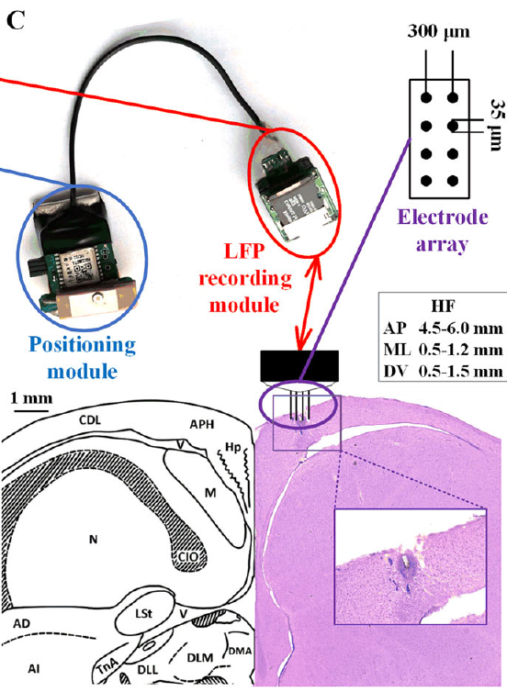
Wearable recordings connect brain signals with flight
A local field potential, or LFP, is an extracellular voltage that reflects coordinated activity and transmembrane currents in surrounding neural tissue. It differs from the isolated action potentials of one identified neuron, because it summarizes the activity of a population.
Yang and colleagues recorded hippocampal LFPs together with position during outdoor pigeon homing. Electrodes sampled the left hippocampal formation, while the positional recorder tracked the flight. Release sites lay more than 0.8 km from the loft, and trials used clear weather with low wind.
The paired records link neural state to behavior during natural movement. The population signal is recorded alongside the flight, which allows neural changes to be read against the bird's position and heading. The overall pattern points to a sensory role that depends on how the cells function, and the next tests address that function.
Yang et al. (2025), Fig. 1C. Recording devices and hippocampal electrode placement.
Yang et al. (2025)
39
Notes:
• A **local field potential**, or LFP, is an extracellular voltage reflecting coordinated activity and transmembrane currents in surrounding neural tissue. It differs from the isolated action potentials of an identified single neuron.
• Yang and colleagues recorded hippocampal LFPs together with position during outdoor pigeon homing. Electrodes sampled the left hippocampal formation, while the positional recorder tracked the flight. Release sites were more than 0.8 km from the loft, and trials used clear weather with low wind.
• The paired records associate neural state with behavior under natural movement conditions. They do not identify a neuron encoding a home vector or establish which transmitter generates the signal; population activity and movement artifacts require separate interpretation.
References:
Yang L, Li M, Yang L, Wang Z, Shang Z (2025). Hippocampal LFP Responses during Pigeon Homing Flight in Outdoors. Journal of Neuroscience 45(30):e0185252025. https://doi.org/10.1523/JNEUROSCI.0185-25.2025
Figure: Yang et al. (2025), Fig. 1C. Recording devices and hippocampal electrode placement.
Figure source: https://doi.org/10.1523/JNEUROSCI.0185-25.2025

Slide 52
Local field potentials sum population activity
A local field potential is an extracellular voltage that reflects coordinated activity in a population of neurons around the electrode. It differs from the spike of one identified neuron, because it sums the currents of many cells at once.
Yang and colleagues recorded hippocampal LFPs and the bird's position at the same time during outdoor homing flights. The electrodes sampled the left hippocampal formation, and the release sites lay more than 0.8 km from the loft. Trials were run in clear weather with low wind.
Recording the population signal during flight allows the neural state to be read against the bird's position and heading. The shared time base is what links a population rhythm to a particular stage of the trip. The population signal therefore reflects the activity of many cells recorded at one electrode.
Yang et al. (2025), Fig. 1C. Recording devices and hippocampal electrode placement.
Yang et al. (2025)
39a
Notes:
• The LFP is a population signal recorded during flight.
• Definition.
– An LFP is an extracellular voltage from many cells.
– It differs from a single neuron's spike.
• Recording.
– LFPs were recorded with the bird's position.
– Both signals share one time base.
• Site.
– Electrodes sampled the left hippocampal formation.
– The side of the recording is fixed.
• Flights.
– Release sites were more than 0.8 km from the loft.
– Trials were run in clear weather with low wind.
• Analysis.
– The population signal is compared across flight stages.
– The position data identify each stage.
• Meaning.
– Population activity tracks the bird's trip.
– The LFP summarizes many cells together.
• Source values.
– The published tracks and the measured values come from the original paper.
– Each value is reported with the scale used in the source.
• Why the measure matters.
– The result separates the bird's measured behavior from the mechanism that produces it.
– The comparison stays within the same birds or sites.
References:
Yang L, Li M, Yang L, Wang Z, Shang Z (2025). Hippocampal LFP Responses during Pigeon Homing Flight in Outdoors. Journal of Neuroscience 45(30):e0185252025. https://doi.org/10.1523/JNEUROSCI.0185-25.2025

Slide 53
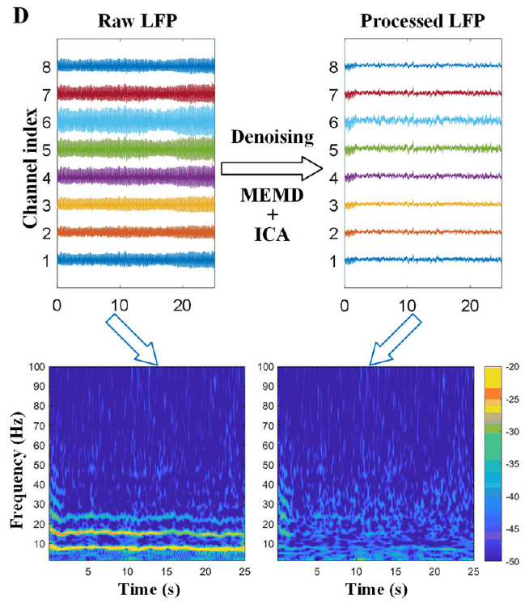
Raw recordings require artifact-aware interpretation
Flight produces muscle activity and electrode movement that can contaminate neural recordings. Denoising separates estimated signal components to reduce these contributions, and the processed data are compared with the original voltages.
Yang and colleagues used multivariate empirical mode decomposition followed by independent component analysis. The source preserves raw and processed multichannel hippocampal traces and their time–frequency power. The recordings span the transition from initial circling to directed flight toward the loft.
The analysis supports stage-associated differences that persist across the processing comparisons. Comparing raw and processed traces keeps the interpretation tied to the measured voltages, so the stage difference rests on the recording itself.
Yang et al. (2025), Fig. 1C. Recording devices and hippocampal electrode placement.
Yang et al. (2025), Fig. 1D. Raw and processed hippocampal recordings.
Yang et al. (2025)
40
Notes:
• Flight produces muscle activity and electrode movement that can contaminate neural recordings. **Denoising** separates estimated signal components to reduce these contributions, but processed data must still be compared with the original voltages.
• Yang and colleagues used multivariate empirical mode decomposition followed by independent component analysis. The source preserves raw and processed multichannel hippocampal traces and their time–frequency power. Recordings spanned the transition from initial circling to directed flight toward the loft.
• The analysis supports stage-associated differences that survived the reported processing comparisons. It cannot exclude every residual artifact or assign each frequency component to a particular cell type. A recording during movement remains correlational even when its preprocessing is carefully controlled.
References:
Yang L, Li M, Yang L, Wang Z, Shang Z (2025). Hippocampal LFP Responses during Pigeon Homing Flight in Outdoors. Journal of Neuroscience 45(30):e0185252025. https://doi.org/10.1523/JNEUROSCI.0185-25.2025
Figure: Yang et al. (2025), Fig. 1D. Raw and processed hippocampal recordings.
Figure source: https://doi.org/10.1523/JNEUROSCI.0185-25.2025
Figure: Yang et al. (2025), Fig. 1C. Recording devices and hippocampal electrode placement.
Figure source: https://doi.org/10.1523/JNEUROSCI.0185-25.2025

Slide 54
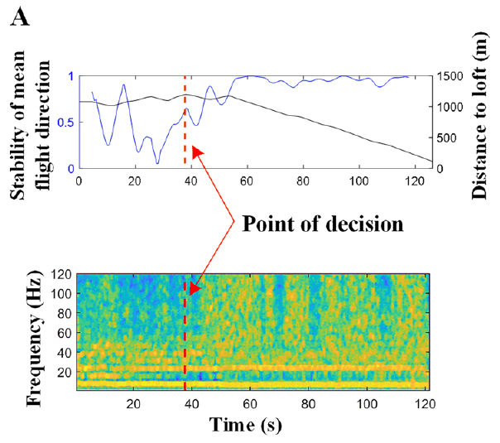
Initial circling differs from sustained homeward flight
The initial decision-making stage, DM, is the early circling or exploratory part of a homing flight. The en route stage, ER, begins when the bird adopts a more stable direction toward home. These are behavioral classifications that organize the flight into two phases.
Yang and colleagues identified the transition from heading stability and distance to the loft, then aligned hippocampal frequency power with that point. The published example tracks both variables over seconds and keeps the LFP frequency axis in hertz.
The alignment relates neural changes to a defined transition in behavior. The hippocampal signal changes around the point where the bird commits to its heading, so the neural and behavioral records line up in time. The stages are defined by the bird's behavior, so the neural data are aligned to the flight rather than to a fixed clock time.
Yang et al. (2025), Fig. 2A. Flight direction, distance and hippocampal frequency power.
Yang et al. (2025), Fig. 1C. Recording devices and hippocampal electrode placement.
Yang et al. (2025)
41
Notes:
• The **initial decision-making stage**, abbreviated DM, is the early circling or exploratory portion of a homing flight. The **en route stage**, abbreviated ER, begins when the bird adopts a more stable direction toward home. These are behavioral classifications rather than direct measurements of subjective decisions.
• Yang and colleagues identified the transition from heading stability and distance to the loft, then aligned hippocampal frequency power with that point. The published example tracks both variables over seconds and retains the LFP frequency axis in hertz.
• The alignment relates neural changes to a defined transition in behavior. It does not prove that the hippocampal signal caused the turn, or that a single instant marks completion of every sensory and memory process involved in selecting the route.
References:
Yang L, Li M, Yang L, Wang Z, Shang Z (2025). Hippocampal LFP Responses during Pigeon Homing Flight in Outdoors. Journal of Neuroscience 45(30):e0185252025. https://doi.org/10.1523/JNEUROSCI.0185-25.2025
Figure: Yang et al. (2025), Fig. 2A. Flight direction, distance and hippocampal frequency power.
Figure source: https://doi.org/10.1523/JNEUROSCI.0185-25.2025
Figure: Yang et al. (2025), Fig. 1C. Recording devices and hippocampal electrode placement.
Figure source: https://doi.org/10.1523/JNEUROSCI.0185-25.2025

Slide 55
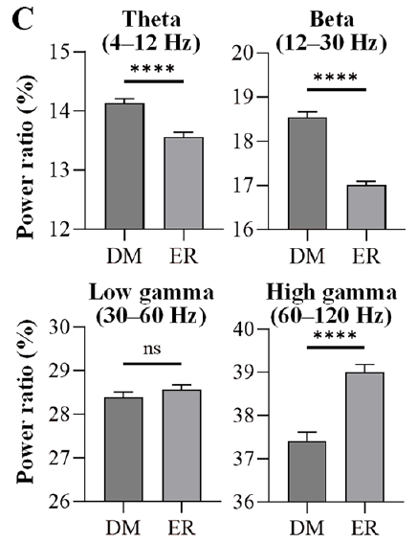
Navigation stages redistribute hippocampal band power
Spectral power measures the contribution of a frequency range to a recorded voltage signal. Yang and colleagues defined theta as 4–12 Hz, beta as 12–30 Hz, low gamma as 30–60 Hz and high gamma as 60–120 Hz.
Theta and beta power ratios were higher during initial decision-making than during en route flight. The high-gamma power ratio was greater en route, whereas low gamma did not show a consistent difference between stages. The comparisons used paired behavioral stages within the same homing flights.
The pattern shows different population activity across flight stages rather than a uniform rise in every band. Each band reflects a different pattern of population activity, and the stage contrast depends on which band is examined.
Yang et al. (2025), Fig. 1C. Recording devices and hippocampal electrode placement.
Yang et al. (2025), Fig. 2C. Frequency-band power during initial and en route navigation.
Yang et al. (2025)
42
Notes:
• **Spectral power** measures the contribution of a frequency range to a recorded voltage signal. Yang and colleagues defined theta as 4–12 Hz, beta as 12–30 Hz, low gamma as 30–60 Hz and high gamma as 60–120 Hz.
• Theta and beta power ratios were higher during initial decision-making than during en route flight. High-gamma power ratio was greater en route, whereas low gamma lacked the same consistent stage difference. The comparisons used paired behavioral stages within the recorded homing flights.
• The pattern supports different population activity across flight stages rather than a uniform increase in every band. Frequency bands do not independently identify a transmitter, inhibitory interneuron or ion channel, and power differences alone cannot establish the content of the spatial representation.
References:
Yang L, Li M, Yang L, Wang Z, Shang Z (2025). Hippocampal LFP Responses during Pigeon Homing Flight in Outdoors. Journal of Neuroscience 45(30):e0185252025. https://doi.org/10.1523/JNEUROSCI.0185-25.2025
Figure: Yang et al. (2025), Fig. 2C. Frequency-band power during initial and en route navigation.
Figure source: https://doi.org/10.1523/JNEUROSCI.0185-25.2025
Figure: Yang et al. (2025), Fig. 1C. Recording devices and hippocampal electrode placement.
Figure source: https://doi.org/10.1523/JNEUROSCI.0185-25.2025

Slide 56
Band power changes between navigation stages
Spectral power measures how much of a recorded voltage falls within a chosen frequency range. Yang and colleagues assigned theta to 4–12 Hz, beta to 12–30 Hz, low gamma to 30–60 Hz and high gamma to 60–120 Hz, so each band has a fixed range.
Theta and beta power ratios were higher in the initial decision-making stage than during en route flight. The high-gamma ratio rose en route, while low gamma showed no consistent difference between stages. The comparisons used paired stages from the same homing flights.
The stages therefore differ in how power is distributed across the bands, rather than in a single overall increase. Each band reflects a separate pattern of population activity, and the stage contrast depends on the band selected.
Yang et al. (2025), Fig. 1C. Recording devices and hippocampal electrode placement.
Yang et al. (2025), Fig. 2C. Frequency-band power during initial and en route navigation.
Yang et al. (2025)
42a
Notes:
• Each frequency band reflects a different pattern of activity.
• Bands.
– Theta is 4–12 Hz and beta is 12–30 Hz.
– Low gamma is 30–60 Hz and high gamma is 60–120 Hz.
• Stages.
– Initial decision-making is the early circling stage.
– En route flight is the stable homeward stage.
• Theta and beta.
– Both ratios were higher during decision-making.
– The ratios fell during the en route stage.
• High gamma.
– High gamma rose during the en route stage.
– Low gamma showed no consistent change.
• Pairing.
– The comparisons used stages from the same flights.
– Individual birds served as their own controls.
• Meaning.
– The stage difference is in the distribution across bands.
– No single band captures the change.
• Source values.
– The published tracks and the measured values come from the original paper.
– Each value is reported with the scale used in the source.
• Why the measure matters.
– The result separates the bird's measured behavior from the mechanism that produces it.
– The comparison stays within the same birds or sites.
References:
Yang L, Li M, Yang L, Wang Z, Shang Z (2025). Hippocampal LFP Responses during Pigeon Homing Flight in Outdoors. Journal of Neuroscience 45(30):e0185252025. https://doi.org/10.1523/JNEUROSCI.0185-25.2025

Slide 57
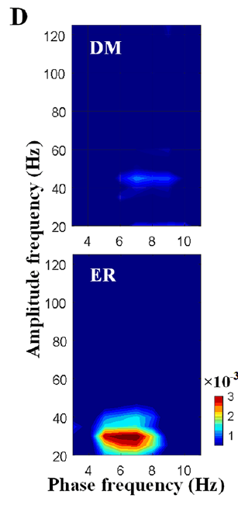
Theta phase organizes beta amplitude during travel
Phase–amplitude coupling means that the amplitude of a faster oscillation varies with the phase of a slower oscillation. Phase specifies position within a repeated voltage cycle, while amplitude measures the size of the faster component.
Yang and colleagues found stronger coupling between theta phase at 5–8 Hz and beta amplitude at 20–30 Hz during en route navigation than during initial decision-making. The source compares the two stages with the same frequency–frequency analysis and its original coupling scale.
The relationship shows stage-dependent coordination of hippocampal population activity. Beta amplitude follows the theta cycle more closely during travel, so the two rhythms are organized together as the flight proceeds. The coupling is measured with the same analysis for both stages, so the comparison between them is direct.
Yang et al. (2025), Fig. 1C. Recording devices and hippocampal electrode placement.
Yang et al. (2025), Fig. 2D. Theta–beta phase–amplitude coupling during navigation.
Yang et al. (2025)
43
Notes:
• **Phase–amplitude coupling** means that the amplitude of a faster oscillation varies with the phase of a slower oscillation. Phase specifies position within a repeated voltage cycle, while amplitude measures the size of the faster component.
• Yang and colleagues found stronger coupling between theta phase at 5–8 Hz and beta amplitude at 20–30 Hz during en route navigation than during initial decision-making. The source compares the two stages using the same frequency–frequency analysis and its original coupling scale.
• The relationship supports stage-dependent coordination of hippocampal population activity. It does not establish information flow from one cell group to another, demonstrate synaptic causation or prove that the oscillations themselves compute the direction and distance to home.
References:
Yang L, Li M, Yang L, Wang Z, Shang Z (2025). Hippocampal LFP Responses during Pigeon Homing Flight in Outdoors. Journal of Neuroscience 45(30):e0185252025. https://doi.org/10.1523/JNEUROSCI.0185-25.2025
Figure: Yang et al. (2025), Fig. 2D. Theta–beta phase–amplitude coupling during navigation.
Figure source: https://doi.org/10.1523/JNEUROSCI.0185-25.2025
Figure: Yang et al. (2025), Fig. 1C. Recording devices and hippocampal electrode placement.
Figure source: https://doi.org/10.1523/JNEUROSCI.0185-25.2025

Slide 58
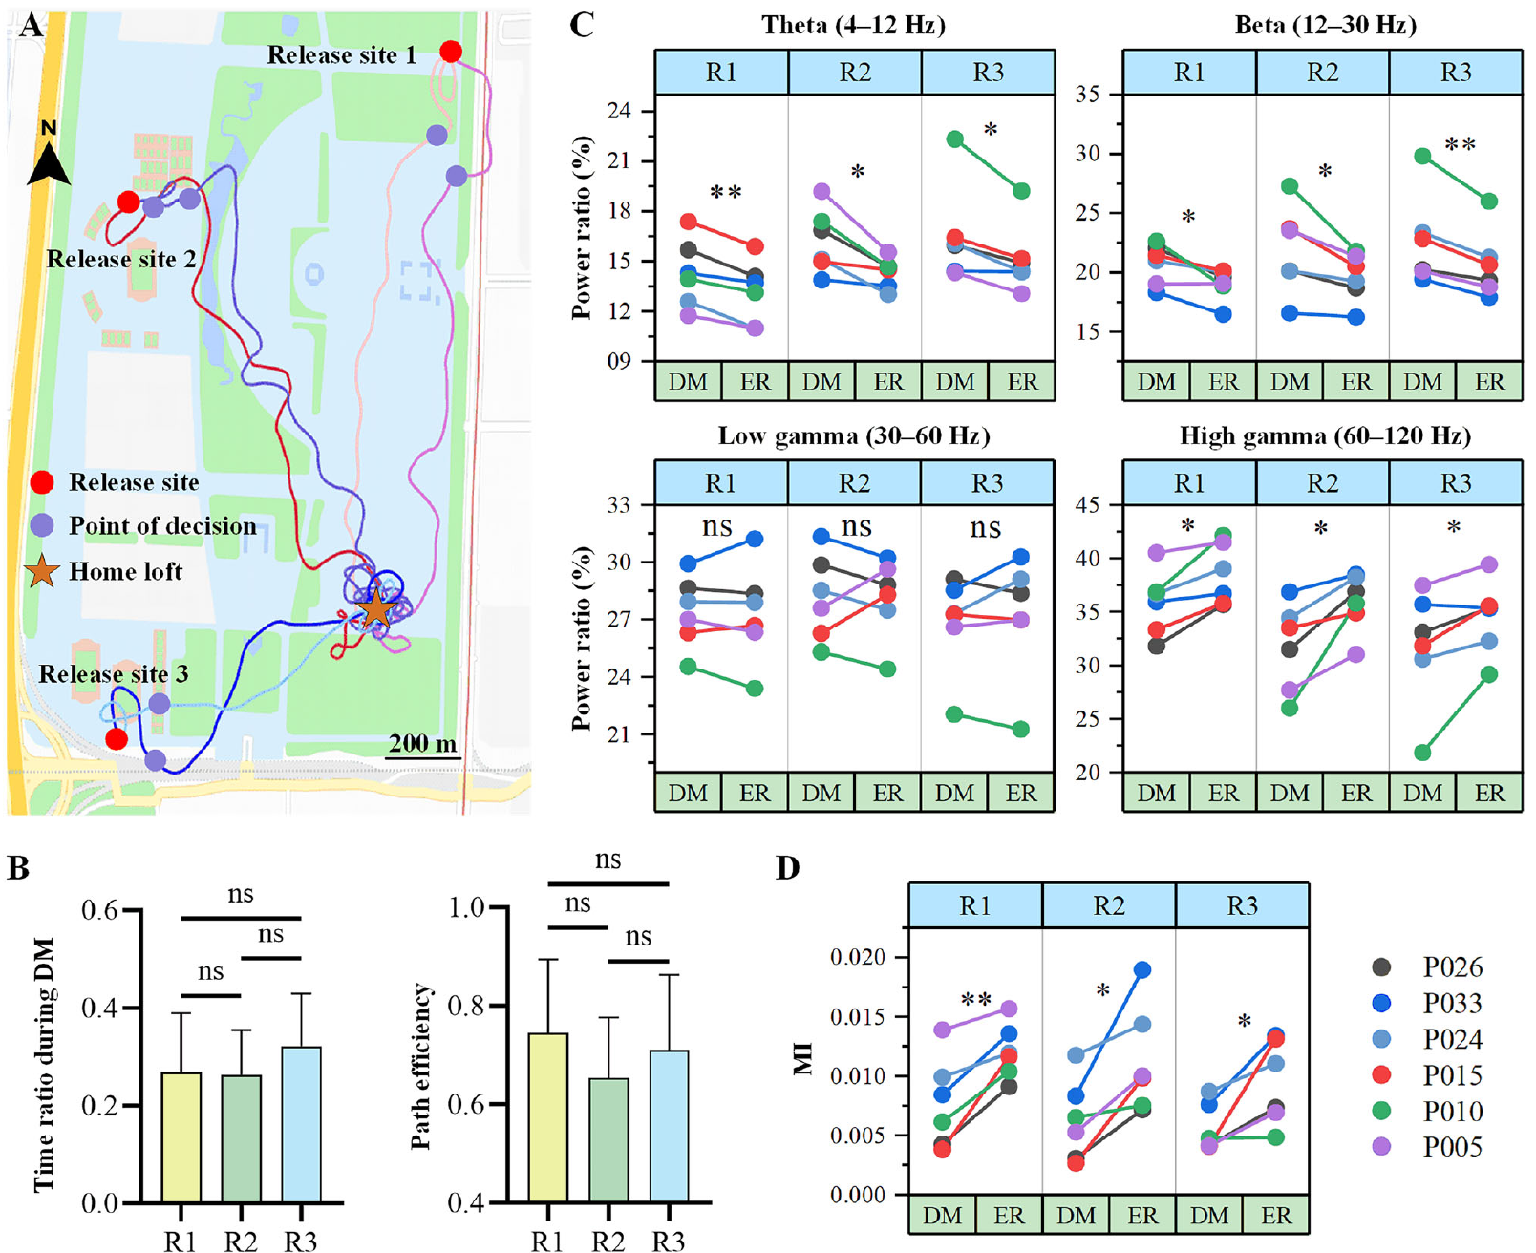
Release direction does not eliminate stage differences
A single release location can confound behavioral stage with a particular heading or piece of terrain. Yang and colleagues alternated among three release sites more than 0.8 km from the loft, comparing initial and en route activity within each direction of approach.
Theta and beta power ratios declined during the transition to en route flight, while high-gamma ratios increased across sites. Theta–beta coupling likewise strengthened en route. The route maps and paired measurements keep each flight and its geographical relationship to the home loft.
The consistency across directions shows that the neural state follows the flight stage rather than a single site. The stage differences held across the three release sites, which supports a general relationship between the stage and the neural state.
Yang et al. (2025), Fig. 3A–D. Behavior and hippocampal activity across three release sites.
Yang et al. (2025)
44
Notes:
• A single release location can confound behavioral stage with a particular heading or piece of terrain. Yang and colleagues alternated among three release sites more than 0.8 km from the loft, comparing initial and en route activity within each direction of approach.
• Theta and beta power ratios declined during the transition to en route flight, while high-gamma ratios increased across sites. Theta–beta coupling likewise strengthened en route. The route maps and paired measurements preserve the individual flights and their geographical relationship to the home loft.
• Consistency across directions reduces a single-site explanation of the observed neural state. It does not prove generality across long-distance releases, unfamiliar environments or every breed of homing pigeon, because the experiment sampled a specific local setting and recording preparation.
References:
Yang L, Li M, Yang L, Wang Z, Shang Z (2025). Hippocampal LFP Responses during Pigeon Homing Flight in Outdoors. Journal of Neuroscience 45(30):e0185252025. https://doi.org/10.1523/JNEUROSCI.0185-25.2025
Figure: Yang et al. (2025), Fig. 3A–D. Behavior and hippocampal activity across three release sites.
Figure source: https://doi.org/10.1523/JNEUROSCI.0185-25.2025

Slide 59
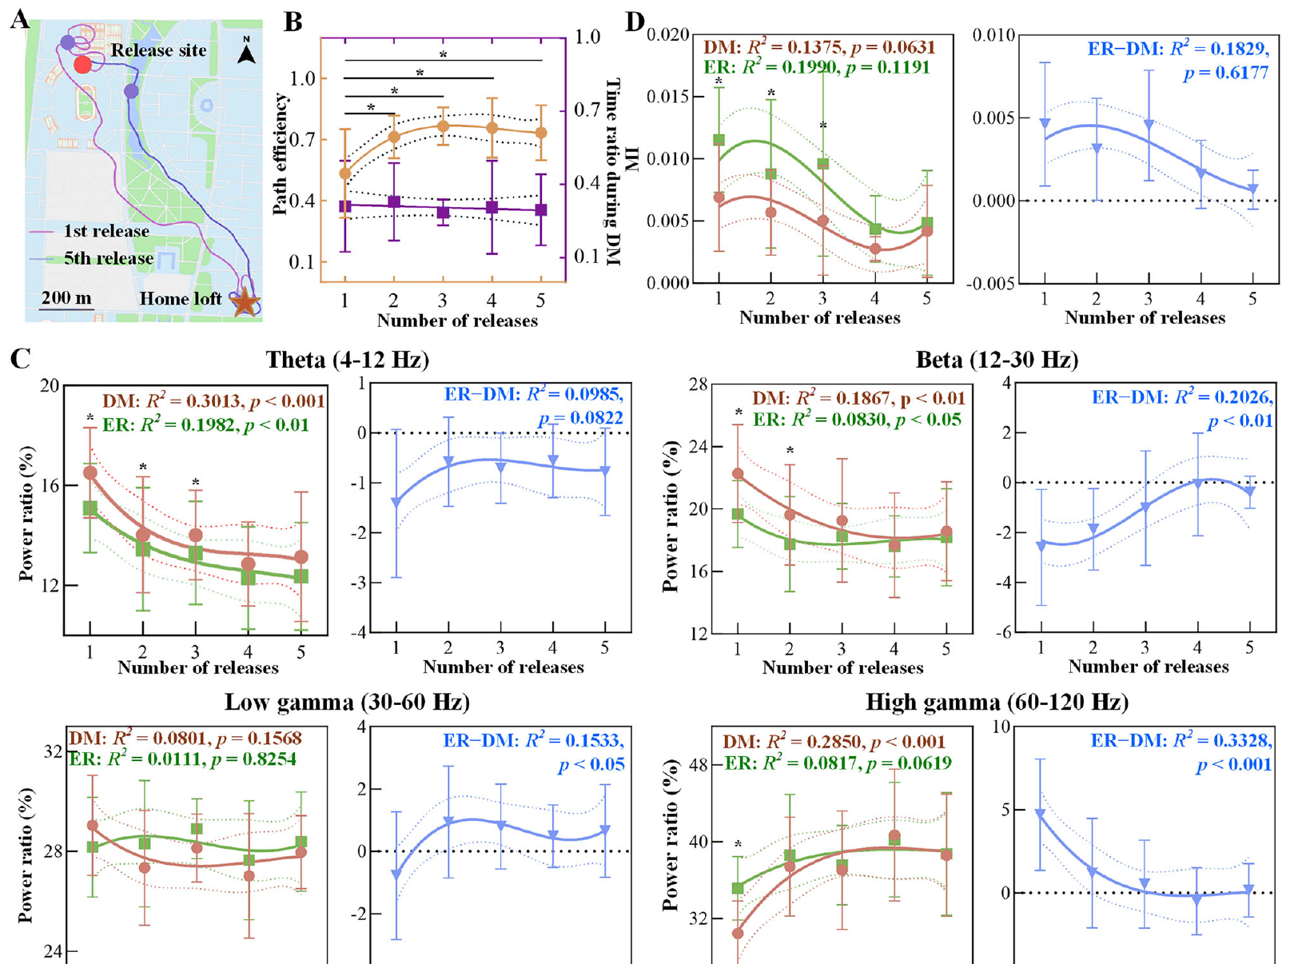
Experience changes routes and neural stage contrasts
Experience-dependent plasticity is a change associated with prior experience. A correlation with repeated journeys shows the association, and the cellular mechanism is a separate question. Yang and colleagues compared five homing releases while continuing to record hippocampal activity and position.
Routes became more efficient with repeated release experience. Differences between initial and en route theta, beta and high-gamma power narrowed, and the stage difference in theta–beta coupling approached zero. The source retains the first and fifth routes and the repeated-release measurements.
The findings link improved navigation with changing population activity. The stage contrast shrinks as the routes improve, which ties the learned route to the neural state of each flight stage. The routes improved with each release, which gives a behavioral baseline for the neural changes.
Yang et al. (2025), Fig. 4A–D. Behavior and hippocampal activity across repeated releases.
Yang et al. (2025)
45
Notes:
• **Experience-dependent plasticity** is a change associated with prior experience; a correlation with repeated journeys does not identify its cellular mechanism. Yang and colleagues compared five homing releases while continuing to record hippocampal activity and position.
• Routes became more efficient with repeated release experience. Differences between initial and en route theta, beta and high-gamma power narrowed, and the stage difference in theta–beta coupling also approached zero. The source retains the first and fifth routes and the repeated-release measurements.
• The findings link behavioral improvement with changing population activity, but do not identify synaptic storage of landmarks or prove that the measured oscillations drive learning. Odor, compass and visual-route evidence concern separable information sources that can interact within such changing navigational states.
References:
Yang L, Li M, Yang L, Wang Z, Shang Z (2025). Hippocampal LFP Responses during Pigeon Homing Flight in Outdoors. Journal of Neuroscience 45(30):e0185252025. https://doi.org/10.1523/JNEUROSCI.0185-25.2025
Figure: Yang et al. (2025), Fig. 4A–D. Behavior and hippocampal activity across repeated releases.
Figure source: https://doi.org/10.1523/JNEUROSCI.0185-25.2025

Slide 60
Key takeaways
Map and compass solve different problems: estimating position relative to home and maintaining a directional reference.
Visual pilotage supports individual familiar routes; clock-shifted pigeons can retain route shape while continuing to respond to compass information.
Environmental odors support early homing in the controlled GPS experiment; artificial odor stimulation alone did not restore that performance.
Regional activation links odor exposure and magnetic stimulation with specific brain regions, but immediate-early-gene labeling is not a real-time code or proof of behavioral causation.
Magnetic mechanisms remain partly unresolved: iron-rich beak cells were macrophages, while V1-dependent responses identify an afferent contribution without locating its receptor.
Hippocampal dynamics vary with flight stage and experience; band power and theta–beta coupling are population correlations, not established cellular computations of a home vector.
Biro et al. (2007); Gagliardo et al. (2011); Yang et al. (2025)
46
Notes:
Teaching transcript:
• Map and compass solve different problems: estimating position relative to home and maintaining a directional reference.
• Visual pilotage supports individual familiar routes; clock-shifted pigeons can retain route shape while continuing to respond to compass information.
• Environmental odors support early homing in the controlled GPS experiment; artificial odor stimulation alone did not restore that performance.
• Regional activation links odor exposure and magnetic stimulation with specific brain regions, but immediate-early-gene labeling is not a real-time code or proof of behavioral causation.
• Magnetic mechanisms remain partly unresolved: iron-rich beak cells were macrophages, while V1-dependent responses identify an afferent contribution without locating its receptor.
• Hippocampal dynamics vary with flight stage and experience; band power and theta–beta coupling are population correlations, not established cellular computations of a home vector.
References:
Biro D, Meade J, Guilford T (2004). Familiar route loyalty implies visual pilotage in the homing pigeon. Proceedings of the National Academy of Sciences 101(50):17440–17443. https://doi.org/10.1073/pnas.0406984101
Biro D, Freeman R, Meade J, Roberts S, Guilford T (2007). Pigeons combine compass and landmark guidance in familiar route navigation. Proceedings of the National Academy of Sciences 104(18):7471–7476. https://doi.org/10.1073/pnas.0701575104
Gagliardo A, Ioalè P, Filannino C, Wikelski M (2011). Homing pigeons only navigate in air with intact environmental odours: a test of the olfactory activation hypothesis with GPS data loggers. PLOS ONE 6(8):e22385. https://doi.org/10.1371/journal.pone.0022385
Jorge PE, Phillips JB, Gonçalves A, Marques PAM, Němec P (2014). Odours stimulate neuronal activity in the dorsolateral area of the hippocampal formation during path integration. Proceedings of the Royal Society B 281(1783):20140025. https://doi.org/10.1098/rspb.2014.0025
Treiber CD, Salzer MC, Riegler J, Edelman N, Sugar C, Breuss M, Pichler P, Cadiou H, Saunders M, Lythgoe M, Shaw J, Keays DA (2012). Clusters of iron-rich cells in the upper beak of pigeons are macrophages not magnetosensitive neurons. Nature 484(7394):367–370. https://doi.org/10.1038/nature11046
Lefeldt N, Heyers D, Schneider NL, Engels S, Elbers D, Mouritsen H (2014). Magnetic field-driven induction of ZENK in the trigeminal system of pigeons (Columba livia). Journal of the Royal Society Interface 11(100):20140777. https://doi.org/10.1098/rsif.2014.0777
Yang L, Li M, Yang L, Wang Z, Shang Z (2025). Hippocampal LFP Responses during Pigeon Homing Flight in Outdoors. Journal of Neuroscience 45(30):e0185252025. https://doi.org/10.1523/JNEUROSCI.0185-25.2025

