Slide 1
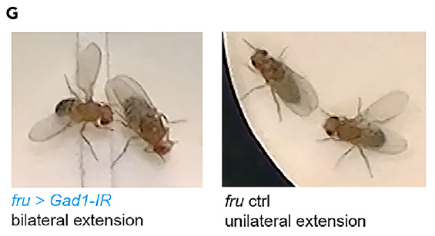
NEUR 411 · NEUROETHOLOGY · FALL 2026
Lecture 34
Vocal communication III:
Drosophila courtship song and the fruitless circuit
Monday, November 16, 2026
Jordan Lopez, Ph.D.
Professor of Neurobiology & Biomedical Engineering
Amin et al. (2023), Fig. 1G. Bilateral wing extension after GAD1 depletion and unilateral control extension.
Notes:
Vocal communication III: Drosophila courtship song and the fruitless circuit
Lecture 34. NEUR 411 · NEUROETHOLOGY · FALL 2026. Monday, November 16, 2026.
Figure: Amin et al. (2023), Fig. 1G. Bilateral wing extension after GAD1 depletion and unilateral control extension.
Figure source: https://doi.org/10.1016/j.isci.2023.108069

Slide 2
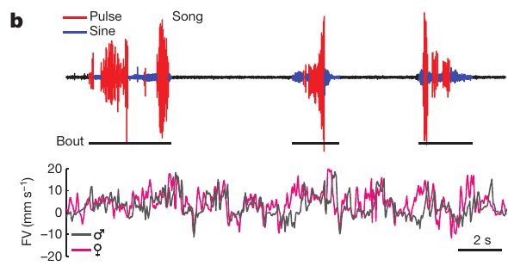
Wing vibration produces two courtship song modes
Courtship song is an acoustic signal produced when a male Drosophila melanogaster vibrates an extended wing while following a female. Pulse song consists of separated sound pulses, whereas sine song is a relatively continuous, approximately sinusoidal vibration.
Coen and colleagues recorded sound and the positions of both flies simultaneously. Their recordings contain transitions between pulse and sine within individual bouts. Related measurements place typical sine carrier frequency at 120–170 Hz and pulse carrier frequency at 150–250 Hz.
Carrier frequency describes oscillations within the sound, whereas the interpulse interval is the time separating successive pulses, commonly around 35 ms in this species. Mode, carrier frequency and pulse spacing are distinct properties; changing one does not establish a change in all three.
Coen et al. (2014), Fig. 1b. Pulse and sine waveforms with simultaneous movement recordings.
Coen et al. (2014); von Philipsborn et al. (2014)
02
Notes:
• **Courtship song** is an acoustic signal produced when a male _Drosophila melanogaster_ vibrates an extended wing while following a female. **Pulse song** consists of separated sound pulses, whereas **sine song** is a relatively continuous, approximately sinusoidal vibration.
• Coen and colleagues recorded sound and the positions of both flies simultaneously. Their recordings contain transitions between pulse and sine within individual bouts. Related measurements place typical sine carrier frequency at 120–170 Hz and pulse carrier frequency at 150–250 Hz.
• **Carrier frequency** describes oscillations within the sound, whereas the **interpulse interval** is the time separating successive pulses, commonly around 35 ms in this species. Mode, carrier frequency and pulse spacing are distinct properties; changing one does not establish a change in all three.
References:
Coen P, Clemens J, Weinstein AJ, Pacheco DA, Deng Y, Murthy M (2014). Dynamic sensory cues shape song structure in Drosophila. Nature 507(7491):233–237. https://doi.org/10.1038/nature13131
von Philipsborn AC, Jörchel S, Tirian L, Demir E, Morita T, Stern DL, Dickson BJ (2014). Cellular and behavioral functions of fruitless isoforms in Drosophila courtship. Current Biology 24(3):242–251. https://doi.org/10.1016/j.cub.2013.12.015
Figure: Coen et al. (2014), Fig. 1b. Pulse and sine waveforms with simultaneous movement recordings.
Figure source: https://doi.org/10.1038/nature13131

Slide 3
Audio and tracking separate song from locomotion
An acoustic recording identifies sound production, while video tracking identifies the movements that accompany it. Coen and colleagues paired males and females in a small chamber above a microphone array and extracted their trajectories during approximately 25 min of courtship.
Males sang during roughly 20% of courtship, with many different pulse–sine sequences rather than repeatedly producing one stereotyped bout. Simultaneous traces distinguish male forward motion, female motion and sound rather than treating movement-associated noise as song.
The preparation permits comparisons between sensory conditions and song choices at short timescales. It does not directly record the activity of an identified neuron, and temporal association between movement and sound cannot by itself distinguish sensory feedback from a shared motor command.
Coen et al. (2014), Fig. 1b. Pulse and sine waveforms with simultaneous movement recordings.
Coen et al. (2014)
03
Notes:
• An acoustic recording identifies sound production, while video tracking identifies the movements that accompany it. Coen and colleagues paired males and females in a small chamber above a microphone array and extracted their trajectories during approximately 25 min of courtship.
• Males sang during roughly 20% of courtship, with many different pulse–sine sequences rather than repeatedly producing one stereotyped bout. Simultaneous traces distinguish male forward motion, female motion and sound rather than treating movement-associated noise as song.
• The preparation permits comparisons between sensory conditions and song choices at short timescales. It does not directly record the activity of an identified neuron, and temporal association between movement and sound cannot by itself distinguish sensory feedback from a shared motor command.
References:
Coen P, Clemens J, Weinstein AJ, Pacheco DA, Deng Y, Murthy M (2014). Dynamic sensory cues shape song structure in Drosophila. Nature 507(7491):233–237. https://doi.org/10.1038/nature13131
Figure: Coen et al. (2014), Fig. 1b. Pulse and sine waveforms with simultaneous movement recordings.
Figure source: https://doi.org/10.1038/nature13131

Slide 4
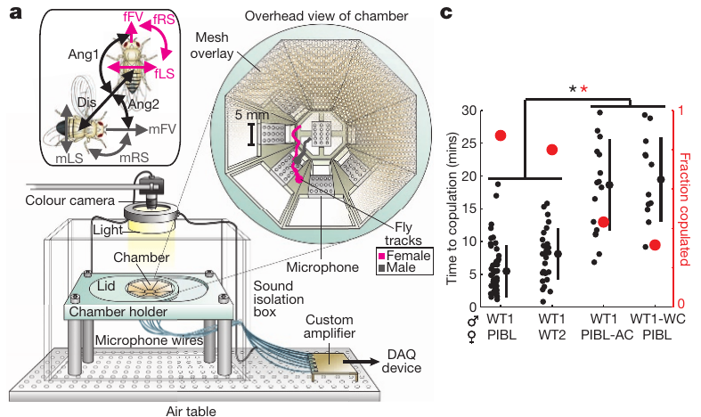
Disrupting hearing or song delays mating
Aristae are the antenna-associated structures removed to disrupt auditory input in this experiment. Cutting a male’s wings instead prevents normal wing-generated song. Coen and colleagues compared these manipulations with intact animals rather than inferring song function from courtship movements alone.
Deafened females and wing-cut males increased the time to copulation and reduced the fraction of pairs that copulated during the approximately 25 min assay. The male and female manipulations therefore affect different sides of the acoustic interaction.
The outcomes support a contribution of song reception and production to successful courtship. Surgical manipulations can have additional effects, so they do not identify a particular auditory receptor or establish that every mating deficit is caused exclusively by loss of one song mode.
Coen et al. (2014), Fig. 1a,c. Recording preparation and mating outcomes after auditory or wing manipulations.
Coen et al. (2014)
04
Notes:
• **Aristae** are the antenna-associated structures removed to disrupt auditory input in this experiment. Cutting a male’s wings instead prevents normal wing-generated song. Coen and colleagues compared these manipulations with intact animals rather than inferring song function from courtship movements alone.
• Deafened females and wing-cut males increased the time to copulation and reduced the fraction of pairs that copulated during the approximately 25 min assay. The male and female manipulations therefore affect different sides of the acoustic interaction.
• The outcomes support a contribution of song reception and production to successful courtship. Surgical manipulations can have additional effects, so they do not identify a particular auditory receptor or establish that every mating deficit is caused exclusively by loss of one song mode.
References:
Coen P, Clemens J, Weinstein AJ, Pacheco DA, Deng Y, Murthy M (2014). Dynamic sensory cues shape song structure in Drosophila. Nature 507(7491):233–237. https://doi.org/10.1038/nature13131
Figure: Coen et al. (2014), Fig. 1a,c. Recording preparation and mating outcomes after auditory or wing manipulations.
Figure source: https://doi.org/10.1038/nature13131

Slide 5
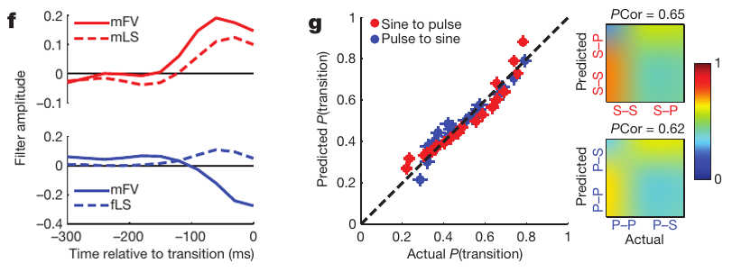
Recent movement predicts changes in song mode
Sensory history is the sequence of information available before a behavioral event. Coen and colleagues tested whether recent movement predicted the initiation of song and transitions between pulse and sine, using histories no longer than 600 ms.
A generalized linear model relates measured movement features to the probability of a song event. Male forward velocity and lateral speed predicted pulse starts, while forward velocity and inter-fly distance contributed to the distinction between pulse and sine starts.
Increasing male forward velocity and lateral speed favored transitions toward pulse; decreases in forward velocity and increases in female lateral speed favored sine. Prediction does not establish the direction of causation, because locomotor commands and sensory consequences can covary within the same courtship interaction.
Coen et al. (2014), Fig. 2f–g. Movement predictors and prediction of pulse–sine transitions.
Coen et al. (2014)
05
Notes:
• **Sensory history** is the sequence of information available before a behavioral event. Coen and colleagues tested whether recent movement predicted the initiation of song and transitions between pulse and sine, using histories no longer than 600 ms.
• A **generalized linear model** relates measured movement features to the probability of a song event. Male forward velocity and lateral speed predicted pulse starts, while forward velocity and inter-fly distance contributed to the distinction between pulse and sine starts.
• Increasing male forward velocity and lateral speed favored transitions toward pulse; decreases in forward velocity and increases in female lateral speed favored sine. Prediction does not establish the direction of causation, because locomotor commands and sensory consequences can covary within the same courtship interaction.
References:
Coen P, Clemens J, Weinstein AJ, Pacheco DA, Deng Y, Murthy M (2014). Dynamic sensory cues shape song structure in Drosophila. Nature 507(7491):233–237. https://doi.org/10.1038/nature13131
Figure: Coen et al. (2014), Fig. 2f–g. Movement predictors and prediction of pulse–sine transitions.
Figure source: https://doi.org/10.1038/nature13131

Slide 6
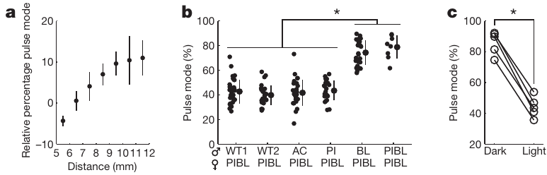
Visual information contributes to song composition
Visual feedback supplies information about a moving partner’s relative position. Coen and colleagues found that the proportion of pulse song increased as the distance between the flies increased, rather than remaining fixed throughout courtship.
The relationship was evaluated across inter-fly distances of approximately 3–12 mm. Males tested in darkness produced more pulse song than under illumination, linking the availability of visual information with song composition while retaining the ability to sing.
The finding is consistent with visual signals contributing to the choice between song modes. Darkness also changes other aspects of the interaction; these behavioral experiments do not identify the complete visual pathway or establish that distance is represented by one dedicated song-control neuron.
Coen et al. (2014), Fig. 3a–c. Distance dependence and visual manipulation of song composition.
Coen et al. (2014)
06
Notes:
• **Visual feedback** supplies information about a moving partner’s relative position. Coen and colleagues found that the proportion of pulse song increased as the distance between the flies increased, rather than remaining fixed throughout courtship.
• The relationship was evaluated across inter-fly distances of approximately 3–12 mm. Males tested in darkness produced more pulse song than under illumination, linking the availability of visual information with song composition while retaining the ability to sing.
• The finding is consistent with visual signals contributing to the choice between song modes. Darkness also changes other aspects of the interaction; these behavioral experiments do not identify the complete visual pathway or establish that distance is represented by one dedicated song-control neuron.
References:
Coen P, Clemens J, Weinstein AJ, Pacheco DA, Deng Y, Murthy M (2014). Dynamic sensory cues shape song structure in Drosophila. Nature 507(7491):233–237. https://doi.org/10.1038/nature13131
Figure: Coen et al. (2014), Fig. 3a–c. Distance dependence and visual manipulation of song composition.
Figure source: https://doi.org/10.1038/nature13131

Slide 7
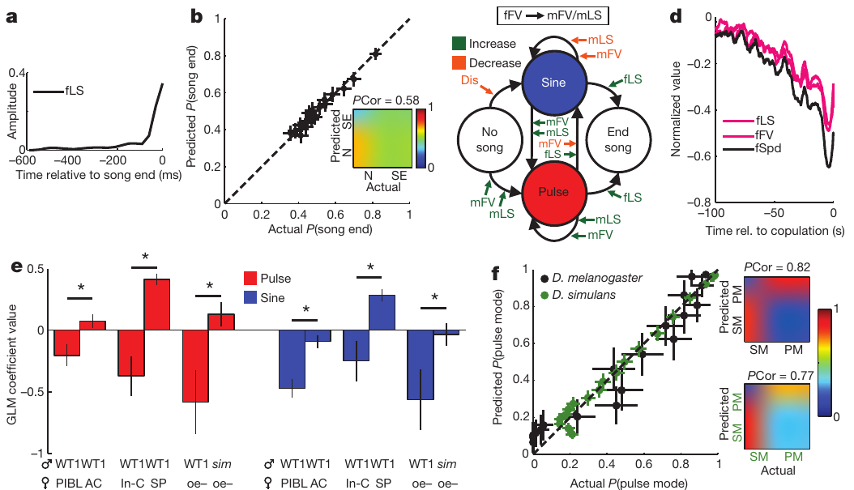
Song and female movement form a dynamic interaction
A female’s movement can change the sensory information available to a singing male, while the male’s song can influence the female’s subsequent movement. Coen and colleagues compared movement and song in paired animals rather than treating courtship as a one-way acoustic broadcast.
Song-related slowing was analyzed in 1 min windows. Female speed decreased before copulation, and relationships between song amount and female speed depended on the paired species and sensory condition. Comparisons included D. melanogaster and D. simulans.
These observations support a dynamic interaction between partner behavior and song patterning. Correlations across a minute do not resolve every immediate auditory response, and differences between species cannot be assigned solely to one song parameter without controlling the other cues available to each female.
Coen et al. (2014), Fig. 4a–f. Song decisions, female responses and species comparisons.
Coen et al. (2014)
07
Notes:
• A female’s movement can change the sensory information available to a singing male, while the male’s song can influence the female’s subsequent movement. Coen and colleagues compared movement and song in paired animals rather than treating courtship as a one-way acoustic broadcast.
• Song-related slowing was analyzed in 1 min windows. Female speed decreased before copulation, and relationships between song amount and female speed depended on the paired species and sensory condition. Comparisons included _D. melanogaster_ and _D. simulans_.
• These observations support a dynamic interaction between partner behavior and song patterning. Correlations across a minute do not resolve every immediate auditory response, and differences between species cannot be assigned solely to one song parameter without controlling the other cues available to each female.
References:
Coen P, Clemens J, Weinstein AJ, Pacheco DA, Deng Y, Murthy M (2014). Dynamic sensory cues shape song structure in Drosophila. Nature 507(7491):233–237. https://doi.org/10.1038/nature13131
Figure: Coen et al. (2014), Fig. 4a–f. Song decisions, female responses and species comparisons.
Figure source: https://doi.org/10.1038/nature13131

Slide 8
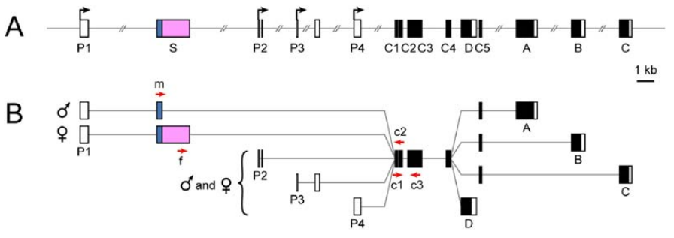
Sex-specific splicing changes fruitless products
RNA splicing joins selected regions of a precursor RNA to produce a mature transcript. The fruitless, or fru, locus spans approximately 130 kb and uses several promoters; transcripts from promoter P1 undergo sex-specific splicing.
In males, the default splice pattern produces FruM, a male-specific transcription factor with a 101-amino-acid amino-terminal extension. A transcription factor regulates gene expression. In females, Transformer-dependent splicing introduces an early stop that prevents production of the corresponding full-length FruM proteins.
Transcripts from other promoters retain functions shared by both sexes. The sex-specific P1 product must therefore be distinguished from the entire gene: eliminating a male-specific splice form is a more focused perturbation than removing every fruitless product.
Demir & Dickson (2005), Fig. 1A–B. The fruitless locus and sex-specific transcript structure.
Demir & Dickson (2005)
08
Notes:
• **RNA splicing** joins selected regions of a precursor RNA to produce a mature transcript. The **fruitless**, or **fru**, locus spans approximately 130 kb and uses several promoters; transcripts from promoter P1 undergo sex-specific splicing.
• In males, the default splice pattern produces **FruM**, a male-specific transcription factor with a 101-amino-acid amino-terminal extension. A **transcription factor** regulates gene expression. In females, Transformer-dependent splicing introduces an early stop that prevents production of the corresponding full-length FruM proteins.
• Transcripts from other promoters retain functions shared by both sexes. The sex-specific P1 product must therefore be distinguished from the entire gene: eliminating a male-specific splice form is a more focused perturbation than removing every fruitless product.
References:
Demir E, Dickson BJ (2005). fruitless splicing specifies male courtship behavior in Drosophila. Cell 121(5):785–794. https://doi.org/10.1016/j.cell.2005.04.027
Figure: Demir & Dickson (2005), Fig. 1A–B. The fruitless locus and sex-specific transcript structure.
Figure source: https://doi.org/10.1016/j.cell.2005.04.027

Slide 9
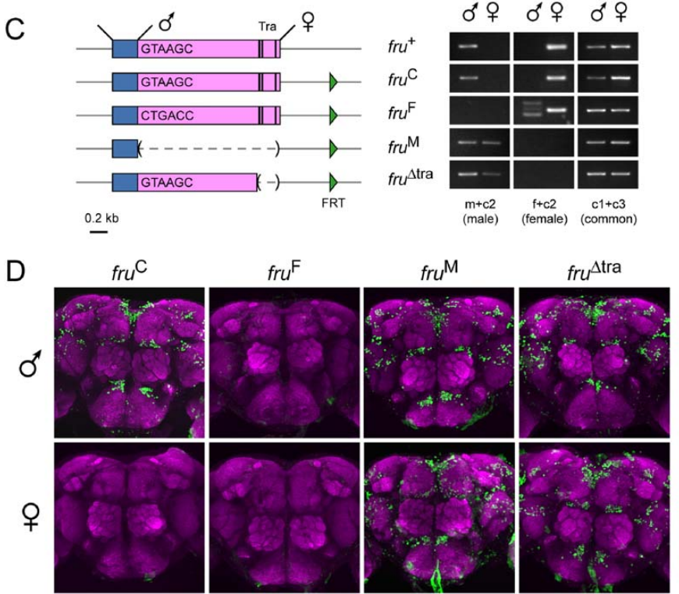
Engineered alleles isolate sex-specific splicing
An allele is a version of a gene. Demir and Dickson changed the sex-specific splice region while preserving other fruitless functions, allowing them to test the consequences of the P1 splice decision directly.
One allele disrupted the male splice donor and forced female-type splicing. A 1601-nucleotide deletion forced male-type splicing, while another allele removed 261 base pairs containing Transformer-binding sites. RNA assays and antibody labeling verified the resulting transcripts and FruM expression in adult brains.
Male-spliced alleles produced FruM labeling in females as well as males; the female-spliced allele removed that labeling in males. Verification connects the behavioral manipulation to its molecular target, but whole-brain labeling does not identify which individual neuronal change causes each courtship phenotype.
Demir & Dickson (2005), Fig. 1C–D. Engineered splice alleles and FruM expression in adult brains.
Demir & Dickson (2005)
09
Notes:
• An **allele** is a version of a gene. Demir and Dickson changed the sex-specific splice region while preserving other fruitless functions, allowing them to test the consequences of the P1 splice decision directly.
• One allele disrupted the male splice donor and forced female-type splicing. A 1601-nucleotide deletion forced male-type splicing, while another allele removed 261 base pairs containing Transformer-binding sites. RNA assays and antibody labeling verified the resulting transcripts and FruM expression in adult brains.
• Male-spliced alleles produced FruM labeling in females as well as males; the female-spliced allele removed that labeling in males. Verification connects the behavioral manipulation to its molecular target, but whole-brain labeling does not identify which individual neuronal change causes each courtship phenotype.
References:
Demir E, Dickson BJ (2005). fruitless splicing specifies male courtship behavior in Drosophila. Cell 121(5):785–794. https://doi.org/10.1016/j.cell.2005.04.027
Figure: Demir & Dickson (2005), Fig. 1C–D. Engineered splice alleles and FruM expression in adult brains.
Figure source: https://doi.org/10.1016/j.cell.2005.04.027

Slide 10
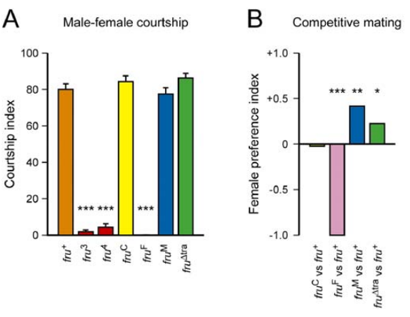
Male fruitless splicing is necessary for normal courtship
Necessity means that removing a factor disrupts an outcome under specified conditions. Demir and Dickson paired males carrying engineered fruitless splice alleles with wild-type virgin females and measured the proportion of observation time devoted to courtship.
Males forced into female-type splicing showed very little female-directed courtship, compared with courtship indices near 80% in control and male-spliced genotypes. Competitive mating assays also separated the female-spliced genotype from males retaining male-type splicing.
The experiment supports a requirement for male P1 splicing in normal male courtship. It does not make FruM an acute electrical command: these alleles act during development and can alter the sensory processing, anatomy and motor organization used by the adult animal.
Demir & Dickson (2005), Fig. 2A–B. Courtship toward females and competitive mating after splice changes.
Demir & Dickson (2005)
10
Notes:
• **Necessity** means that removing a factor disrupts an outcome under specified conditions. Demir and Dickson paired males carrying engineered fruitless splice alleles with wild-type virgin females and measured the proportion of observation time devoted to courtship.
• Males forced into female-type splicing showed very little female-directed courtship, compared with courtship indices near 80% in control and male-spliced genotypes. Competitive mating assays also separated the female-spliced genotype from males retaining male-type splicing.
• The experiment supports a requirement for male P1 splicing in normal male courtship. It does not make FruM an acute electrical command: these alleles act during development and can alter the sensory processing, anatomy and motor organization used by the adult animal.
References:
Demir E, Dickson BJ (2005). fruitless splicing specifies male courtship behavior in Drosophila. Cell 121(5):785–794. https://doi.org/10.1016/j.cell.2005.04.027
Figure: Demir & Dickson (2005), Fig. 2A–B. Courtship toward females and competitive mating after splice changes.
Figure source: https://doi.org/10.1016/j.cell.2005.04.027

Slide 11
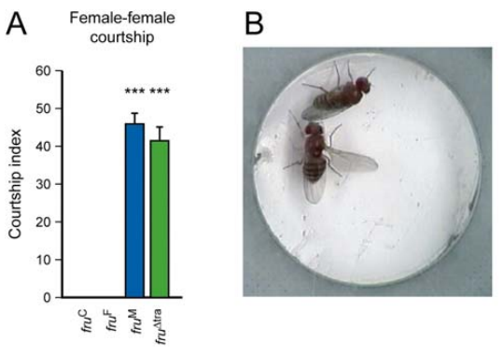
Male-spliced fruitless enables courtship in females
Sufficiency means that adding or enabling a factor produces an outcome in a defined background. Demir and Dickson tested females engineered to express male-spliced fruitless, pairing them with wild-type virgin females.
These animals performed female-directed courtship with indices above 40%, while control females showed essentially none. Wing extension, tapping and other courtship actions occurred, although the engineered females did not complete male copulation and the individual components were not quantitatively identical to those of males.
The result supports developmental sufficiency for many male-typical courtship actions in this genetic background. It does not establish that FruM alone supplies every male anatomical feature, that all behaviors become male-like, or that the same manipulation has identical effects in every species.
Demir & Dickson (2005), Fig. 4A–B. Courtship by females engineered to express male-spliced fruitless.
Demir & Dickson (2005)
11
Notes:
• **Sufficiency** means that adding or enabling a factor produces an outcome in a defined background. Demir and Dickson tested females engineered to express male-spliced fruitless, pairing them with wild-type virgin females.
• These animals performed female-directed courtship with indices above 40%, while control females showed essentially none. Wing extension, tapping and other courtship actions occurred, although the engineered females did not complete male copulation and the individual components were not quantitatively identical to those of males.
• The result supports developmental sufficiency for many male-typical courtship actions in this genetic background. It does not establish that FruM alone supplies every male anatomical feature, that all behaviors become male-like, or that the same manipulation has identical effects in every species.
References:
Demir E, Dickson BJ (2005). fruitless splicing specifies male courtship behavior in Drosophila. Cell 121(5):785–794. https://doi.org/10.1016/j.cell.2005.04.027
Figure: Demir & Dickson (2005), Fig. 4A–B. Courtship by females engineered to express male-spliced fruitless.
Figure source: https://doi.org/10.1016/j.cell.2005.04.027

Slide 12
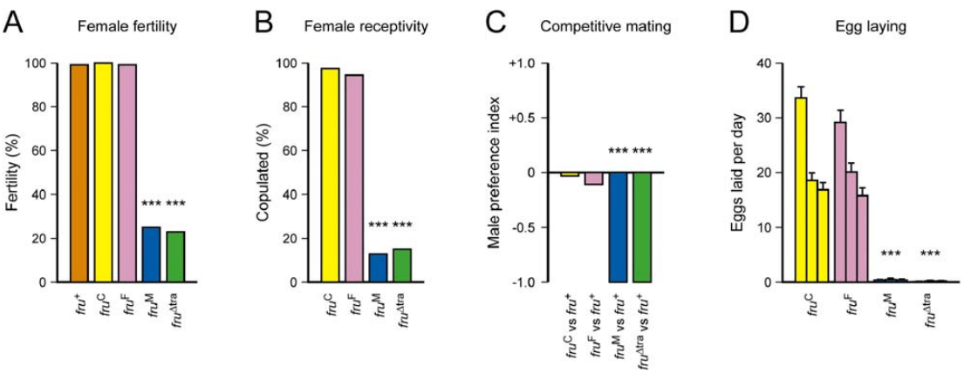
FruM also alters female reproductive behavior
Courtship production and reproductive receptivity are separable behavioral outcomes. Demir and Dickson tested whether forcing male fruitless splicing in females affected mating, fertility and egg laying rather than examining only the newly expressed courtship actions.
Most control females copulated within 60 min, whereas fewer than 16% of females carrying the male-spliced alleles did so. After mating, control females laid more than 65 eggs over three days on average, while engineered females laid fewer than two.
No gross genital abnormality explained the entire phenotype. The findings associate FruM with suppression of female reproductive behaviors, but they do not identify a single inhibitory synapse or show that reduced receptivity and reduced egg laying arise from precisely the same neurons.
Demir & Dickson (2005), Fig. 3A–D. Fertility, mating receptivity and egg laying after splice changes.
Demir & Dickson (2005)
12
Notes:
• Courtship production and reproductive receptivity are separable behavioral outcomes. Demir and Dickson tested whether forcing male fruitless splicing in females affected mating, fertility and egg laying rather than examining only the newly expressed courtship actions.
• Most control females copulated within 60 min, whereas fewer than 16% of females carrying the male-spliced alleles did so. After mating, control females laid more than 65 eggs over three days on average, while engineered females laid fewer than two.
• No gross genital abnormality explained the entire phenotype. The findings associate FruM with suppression of female reproductive behaviors, but they do not identify a single inhibitory synapse or show that reduced receptivity and reduced egg laying arise from precisely the same neurons.
References:
Demir E, Dickson BJ (2005). fruitless splicing specifies male courtship behavior in Drosophila. Cell 121(5):785–794. https://doi.org/10.1016/j.cell.2005.04.027
Figure: Demir & Dickson (2005), Fig. 3A–D. Fertility, mating receptivity and egg laying after splice changes.
Figure source: https://doi.org/10.1016/j.cell.2005.04.027

Slide 13
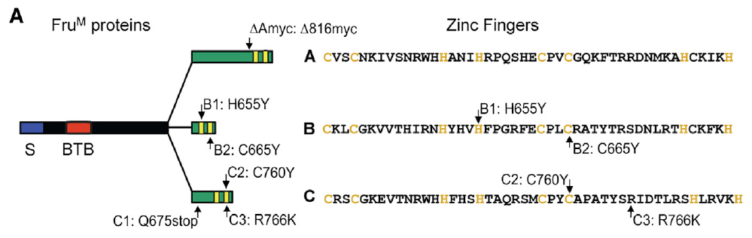
Distinct Fru isoforms have different DNA-binding domains
An isoform is one of several related protein products of a gene. Male-specific fruitless transcripts can produce FruA, FruB and FruC, which share amino-terminal regions but differ in their carboxy-terminal zinc-finger domains, protein regions involved in binding DNA.
von Philipsborn and colleagues selectively disrupted these isoforms and compared their effects with controls. The three forms retain a shared BTB domain, involved in protein interactions, while their distinct endings provide a molecular basis for different regulatory functions.
Sine carrier frequencies normally occupy roughly 120–170 Hz, and selective isoform disruption produced distinct song phenotypes. These results connect transcription-factor identity with behavior, but they do not by themselves specify the downstream genes or ion channels responsible for every altered song property.
von Philipsborn et al. (2014), Fig. 2A. Shared and distinct domains of the FruM isoforms.
von Philipsborn et al. (2014)
13
Notes:
• An **isoform** is one of several related protein products of a gene. Male-specific fruitless transcripts can produce FruA, FruB and FruC, which share amino-terminal regions but differ in their carboxy-terminal **zinc-finger domains**, protein regions involved in binding DNA.
• von Philipsborn and colleagues selectively disrupted these isoforms and compared their effects with controls. The three forms retain a shared **BTB domain**, involved in protein interactions, while their distinct endings provide a molecular basis for different regulatory functions.
• Sine carrier frequencies normally occupy roughly 120–170 Hz, and selective isoform disruption produced distinct song phenotypes. These results connect transcription-factor identity with behavior, but they do not by themselves specify the downstream genes or ion channels responsible for every altered song property.
References:
von Philipsborn AC, Jörchel S, Tirian L, Demir E, Morita T, Stern DL, Dickson BJ (2014). Cellular and behavioral functions of fruitless isoforms in Drosophila courtship. Current Biology 24(3):242–251. https://doi.org/10.1016/j.cub.2013.12.015
Figure: von Philipsborn et al. (2014), Fig. 2A. Shared and distinct domains of the FruM isoforms.
Figure source: https://doi.org/10.1016/j.cub.2013.12.015

Slide 14
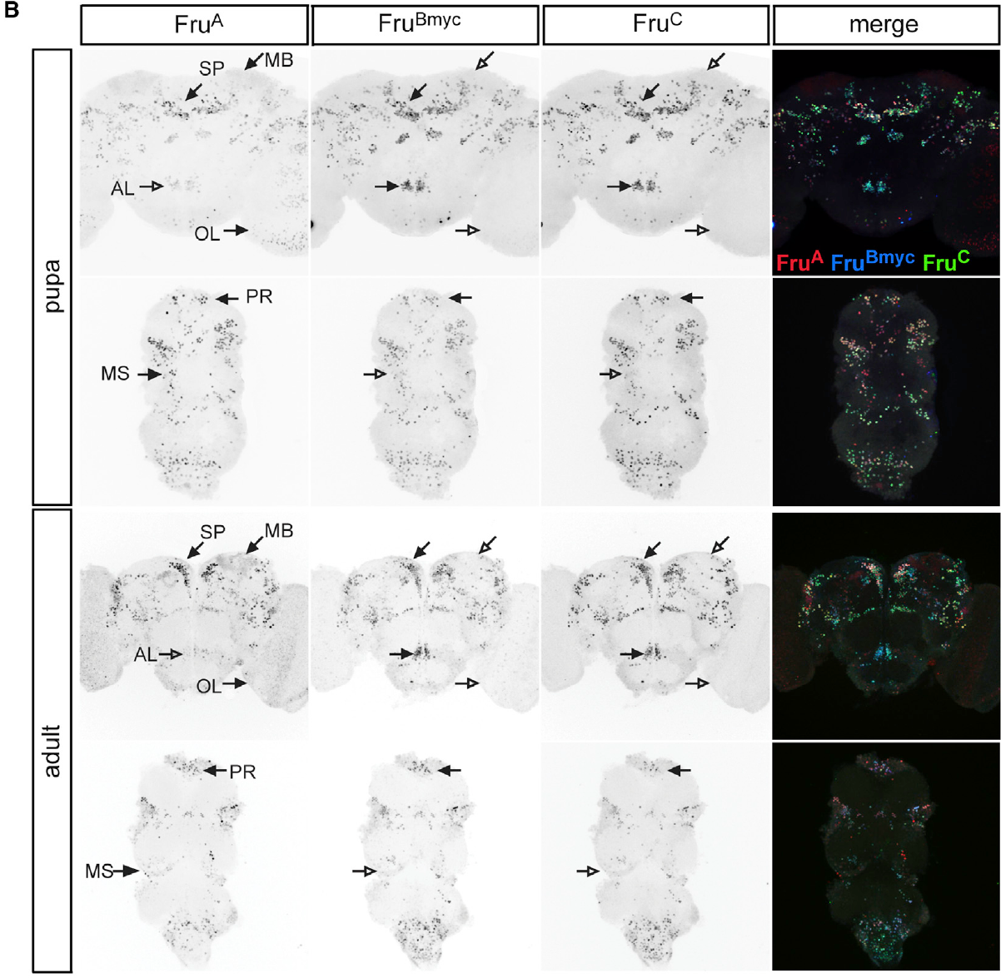
Fru isoforms overlap within brain and nerve cord
The ventral nerve cord, or VNC, contains the thoracic circuitry controlling the wings. Immunolabeling of pupal and adult nervous systems allowed von Philipsborn and colleagues to compare Fru isoform expression before and after adult emergence.
Most fruitless-positive neuronal classes coexpressed FruA, FruB and FruC rather than forming three mutually exclusive populations. Expression extended through brain and VNC, placing the different transcription-factor isoforms in neurons that participate in sensory processing and motor control.
Despite this overlap, isoform mutants differed in their production of pulse song, whose usual interpulse interval is about 35 ms. Coexpression therefore does not imply interchangeable function. Antibody labeling establishes protein distribution, while genetic perturbation is needed to test the contribution of a particular isoform.
von Philipsborn et al. (2014), Fig. 1B. Isoform expression in pupal and adult brain and nerve cord.
von Philipsborn et al. (2014)
14
Notes:
• The **ventral nerve cord**, or VNC, contains the thoracic circuitry controlling the wings. Immunolabeling of pupal and adult nervous systems allowed von Philipsborn and colleagues to compare Fru isoform expression before and after adult emergence.
• Most fruitless-positive neuronal classes coexpressed FruA, FruB and FruC rather than forming three mutually exclusive populations. Expression extended through brain and VNC, placing the different transcription-factor isoforms in neurons that participate in sensory processing and motor control.
• Despite this overlap, isoform mutants differed in their production of pulse song, whose usual interpulse interval is about 35 ms. Coexpression therefore does not imply interchangeable function. Antibody labeling establishes protein distribution, while genetic perturbation is needed to test the contribution of a particular isoform.
References:
von Philipsborn AC, Jörchel S, Tirian L, Demir E, Morita T, Stern DL, Dickson BJ (2014). Cellular and behavioral functions of fruitless isoforms in Drosophila courtship. Current Biology 24(3):242–251. https://doi.org/10.1016/j.cub.2013.12.015
Figure: von Philipsborn et al. (2014), Fig. 1B. Isoform expression in pupal and adult brain and nerve cord.
Figure source: https://doi.org/10.1016/j.cub.2013.12.015

Slide 15
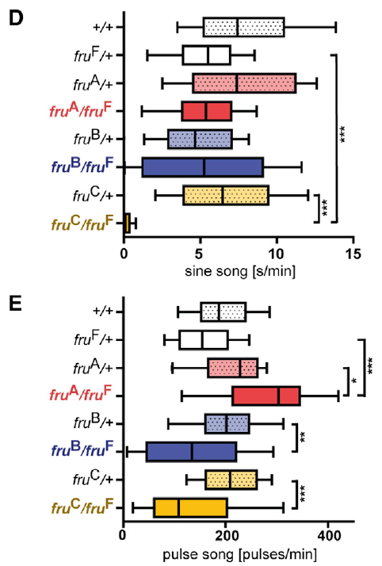
FruC disruption strongly impairs song and mating
Isoform-specific mutations distinguish a general requirement for fruitless from a requirement for one of its protein endings. von Philipsborn and colleagues paired mutant males with virgin females and recorded pulse song, sine song and copulation.
FruC mutants lacked normal sine song and had the strongest mating impairment among the isoform mutants. Sine normally has a carrier frequency of approximately 120–170 Hz; its disappearance is therefore a loss of a song mode rather than merely a small shift in pulse spacing.
FruA and FruB perturbations produced different, less severe combinations of defects. The contrast supports nonredundant isoform functions in the courtship network, but a lifelong mutation can influence multiple cell types and does not isolate the acute site at which sine production fails.
von Philipsborn et al. (2014), Fig. 2D–E. Sine and pulse production in isoform mutants.
von Philipsborn et al. (2014)
15
Notes:
• Isoform-specific mutations distinguish a general requirement for fruitless from a requirement for one of its protein endings. von Philipsborn and colleagues paired mutant males with virgin females and recorded pulse song, sine song and copulation.
• FruC mutants lacked normal sine song and had the strongest mating impairment among the isoform mutants. Sine normally has a carrier frequency of approximately 120–170 Hz; its disappearance is therefore a loss of a song mode rather than merely a small shift in pulse spacing.
• FruA and FruB perturbations produced different, less severe combinations of defects. The contrast supports nonredundant isoform functions in the courtship network, but a lifelong mutation can influence multiple cell types and does not isolate the acute site at which sine production fails.
References:
von Philipsborn AC, Jörchel S, Tirian L, Demir E, Morita T, Stern DL, Dickson BJ (2014). Cellular and behavioral functions of fruitless isoforms in Drosophila courtship. Current Biology 24(3):242–251. https://doi.org/10.1016/j.cub.2013.12.015
Figure: von Philipsborn et al. (2014), Fig. 2D–E. Sine and pulse production in isoform mutants.
Figure source: https://doi.org/10.1016/j.cub.2013.12.015

Slide 16
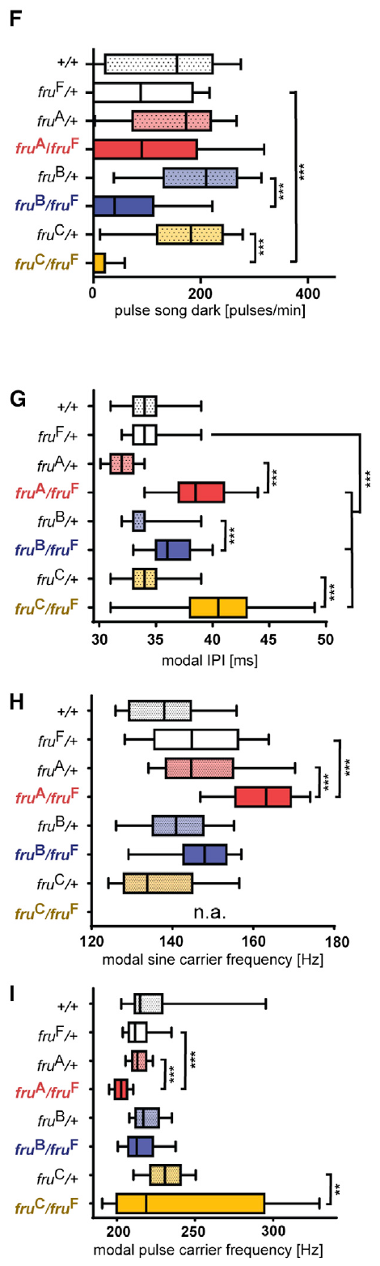
Isoform phenotypes include timing and sensory dependence
Song amount, carrier frequency and interpulse timing quantify different outputs of the courtship circuit. von Philipsborn and colleagues measured these parameters separately in selective Fru isoform mutants, comparing illuminated and dark courtship conditions.
FruC loss strongly reduced pulse production in darkness and lengthened interpulse timing relative to the approximately 35 ms control pattern. Carrier frequencies also differed among isoform mutants rather than tracking the loss of song amount in one uniform way.
The dependence on illumination is consistent with altered access to nonvisual courtship information. It does not establish that FruC is a photoreceptor protein or a pulse-timing channel: the developmental mutation can change the pathways that translate available sensory cues into motor activity.
von Philipsborn et al. (2014), Fig. 2F–I. Darkness, interpulse timing and carrier frequencies in isoform mutants.
von Philipsborn et al. (2014)
16
Notes:
• Song amount, carrier frequency and interpulse timing quantify different outputs of the courtship circuit. von Philipsborn and colleagues measured these parameters separately in selective Fru isoform mutants, comparing illuminated and dark courtship conditions.
• FruC loss strongly reduced pulse production in darkness and lengthened interpulse timing relative to the approximately 35 ms control pattern. Carrier frequencies also differed among isoform mutants rather than tracking the loss of song amount in one uniform way.
• The dependence on illumination is consistent with altered access to nonvisual courtship information. It does not establish that FruC is a photoreceptor protein or a pulse-timing channel: the developmental mutation can change the pathways that translate available sensory cues into motor activity.
References:
von Philipsborn AC, Jörchel S, Tirian L, Demir E, Morita T, Stern DL, Dickson BJ (2014). Cellular and behavioral functions of fruitless isoforms in Drosophila courtship. Current Biology 24(3):242–251. https://doi.org/10.1016/j.cub.2013.12.015
Figure: von Philipsborn et al. (2014), Fig. 2F–I. Darkness, interpulse timing and carrier frequencies in isoform mutants.
Figure source: https://doi.org/10.1016/j.cub.2013.12.015

Slide 17
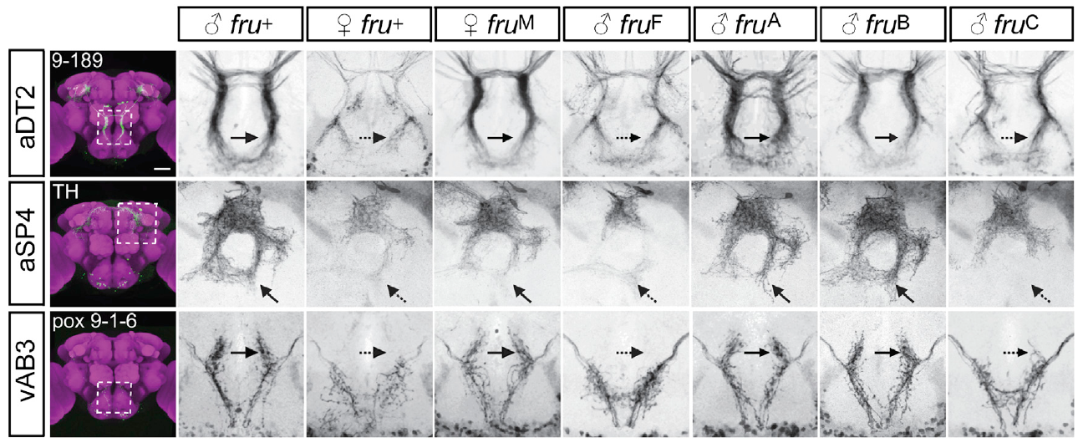
FruC specifies sexually differentiated neuronal arbors
A neuronal arbor is the branching region through which a neuron receives or distributes signals. von Philipsborn and colleagues labeled identified courtship-related classes and registered their anatomy across male, female and fruitless-mutant nervous systems.
FruC was required for male-typical arborization in classes including aSP4 and vAB3. Mutants lacking this isoform also showed reduced pulse song without visual cues; normal song spacing is approximately 35 ms, but anatomical and behavioral changes measure different levels of the phenotype.
The results link a specific transcription-factor isoform with sex-dependent neuronal morphology. Arbor shape can constrain possible connectivity, yet light-microscopic overlap does not establish a synapse or determine whether a particular connection is excitatory, inhibitory or behaviorally necessary.
von Philipsborn et al. (2014), Fig. 3. Sex-specific neuronal arbors across fruitless genotypes.
von Philipsborn et al. (2014)
17
Notes:
• A neuronal **arbor** is the branching region through which a neuron receives or distributes signals. von Philipsborn and colleagues labeled identified courtship-related classes and registered their anatomy across male, female and fruitless-mutant nervous systems.
• FruC was required for male-typical arborization in classes including aSP4 and vAB3. Mutants lacking this isoform also showed reduced pulse song without visual cues; normal song spacing is approximately 35 ms, but anatomical and behavioral changes measure different levels of the phenotype.
• The results link a specific transcription-factor isoform with sex-dependent neuronal morphology. Arbor shape can constrain possible connectivity, yet light-microscopic overlap does not establish a synapse or determine whether a particular connection is excitatory, inhibitory or behaviorally necessary.
References:
von Philipsborn AC, Jörchel S, Tirian L, Demir E, Morita T, Stern DL, Dickson BJ (2014). Cellular and behavioral functions of fruitless isoforms in Drosophila courtship. Current Biology 24(3):242–251. https://doi.org/10.1016/j.cub.2013.12.015
Figure: von Philipsborn et al. (2014), Fig. 3. Sex-specific neuronal arbors across fruitless genotypes.
Figure source: https://doi.org/10.1016/j.cub.2013.12.015

Slide 18
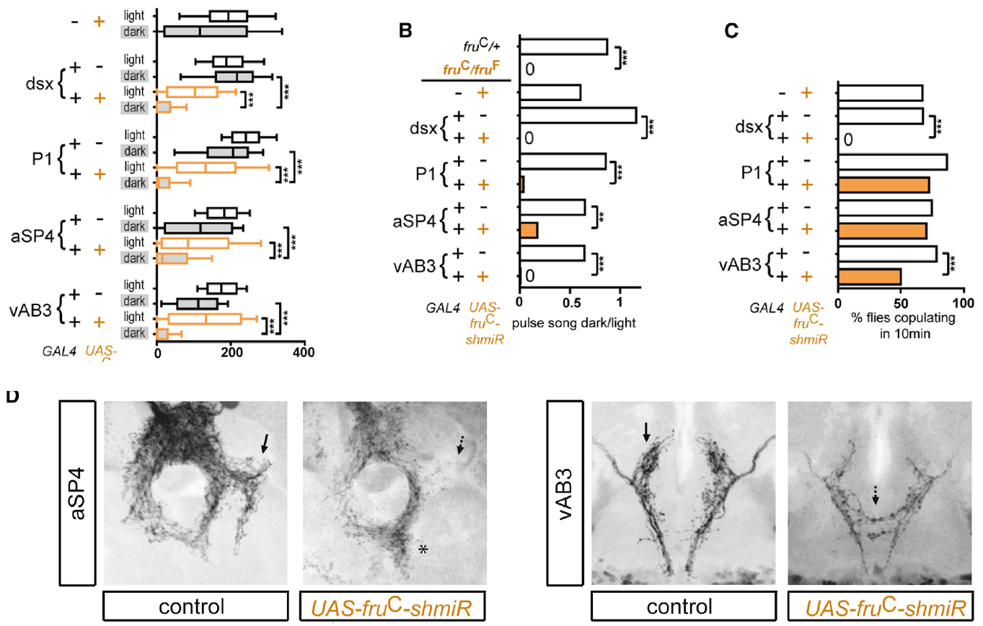
Cell-specific FruC loss impairs nonvisual courtship
Cell-specific knockdown reduces a gene product in selected neurons while preserving it elsewhere. von Philipsborn and colleagues depleted FruC in defined courtship-related classes and compared pulse production under illumination and in darkness.
Loss in aSP4 or vAB3 feminized characteristic arbors and impaired dark courtship. The copulation assay extended over 10 min, while song comparisons separated pulse amount in light from pulse amount in dark rather than assuming both conditions accessed identical sensory information.
P1 neuron presence depended on the sex-determination gene doublesex rather than on fruitless alone. FruM can enable broad courtship behavior without independently specifying every male neuron; the developmental pathway involves several genetic contributions whose cellular consequences must be tested separately.
von Philipsborn et al. (2014), Fig. 4A–D. Cell-specific behavioral effects and associated courtship-pathway arbors.
von Philipsborn et al. (2014)
18
Notes:
• **Cell-specific knockdown** reduces a gene product in selected neurons while preserving it elsewhere. von Philipsborn and colleagues depleted FruC in defined courtship-related classes and compared pulse production under illumination and in darkness.
• Loss in aSP4 or vAB3 feminized characteristic arbors and impaired dark courtship. The copulation assay extended over 10 min, while song comparisons separated pulse amount in light from pulse amount in dark rather than assuming both conditions accessed identical sensory information.
• P1 neuron presence depended on the sex-determination gene doublesex rather than on fruitless alone. FruM can enable broad courtship behavior without independently specifying every male neuron; the developmental pathway involves several genetic contributions whose cellular consequences must be tested separately.
References:
von Philipsborn AC, Jörchel S, Tirian L, Demir E, Morita T, Stern DL, Dickson BJ (2014). Cellular and behavioral functions of fruitless isoforms in Drosophila courtship. Current Biology 24(3):242–251. https://doi.org/10.1016/j.cub.2013.12.015
Figure: von Philipsborn et al. (2014), Fig. 4A–D. Cell-specific behavioral effects and associated courtship-pathway arbors.
Figure source: https://doi.org/10.1016/j.cub.2013.12.015

Slide 19
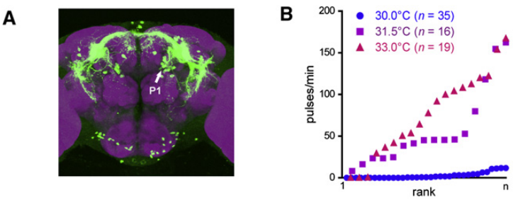
Activating P1-containing neurons initiates pulse song
P1 neurons are a male-specific brain population associated with courtship initiation. von Philipsborn and colleagues used intersecting genetic expression patterns to place the heat-gated TrpA1 cation channel in restricted fruitless-positive neurons.
Heating isolated males to approximately 30–33 °C opened the experimentally expressed channel, increasing inward cation current and neuronal excitability. Activation of a P1-containing population elicited pulse trains with timing close to natural courtship song.
Stochastic labeling helped associate singing with P1 expression rather than with every neuron in the driver pattern. Artificial activation establishes a song-promoting capacity; it does not imply that normal courtship requires heating or that TrpA1 is the endogenous trigger for song production.
von Philipsborn et al. (2011), Fig. 2A–B. P1 labeling and temperature-dependent song activation.
von Philipsborn et al. (2011)
19
Notes:
• **P1 neurons** are a male-specific brain population associated with courtship initiation. von Philipsborn and colleagues used intersecting genetic expression patterns to place the heat-gated **TrpA1 cation channel** in restricted fruitless-positive neurons.
• Heating isolated males to approximately 30–33 °C opened the experimentally expressed channel, increasing inward cation current and neuronal excitability. Activation of a P1-containing population elicited pulse trains with timing close to natural courtship song.
• Stochastic labeling helped associate singing with P1 expression rather than with every neuron in the driver pattern. Artificial activation establishes a song-promoting capacity; it does not imply that normal courtship requires heating or that TrpA1 is the endogenous trigger for song production.
References:
von Philipsborn AC, Liu T, Yu JY, Masser C, Bidaye SS, Dickson BJ (2011). Neuronal control of Drosophila courtship song. Neuron 69(3):509–522. https://doi.org/10.1016/j.neuron.2011.01.011
Figure: von Philipsborn et al. (2011), Fig. 2A–B. P1 labeling and temperature-dependent song activation.
Figure source: https://doi.org/10.1016/j.neuron.2011.01.011

Slide 20
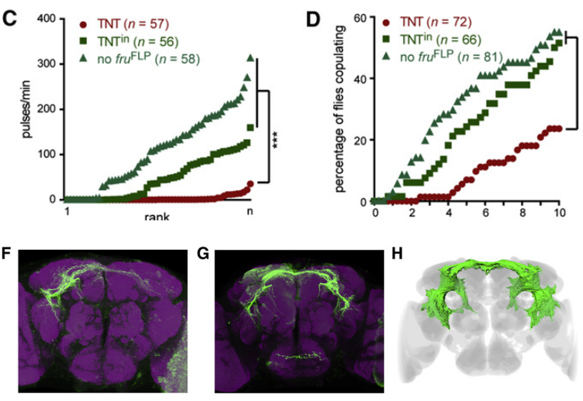
Silencing tests a requirement for P1 transmission
Synaptic silencing blocks communication from a neuron rather than removing its anatomy. The 2011 study expressed tetanus-toxin light chain in a P1-containing fruitless-positive population; this protein cleaves a component required for synaptic vesicle release.
Males paired with virgin females produced fewer pulse trains and had reduced copulation success during the 10 min assay. Controls expressed an inactive toxin or lacked the genetic intersection that directed the active toxin into the target population.
The contrast supports a requirement for transmission from these neurons under the tested conditions. Driver expression included additional cells, so the population-level silencing result must be interpreted together with restricted activation and anatomical labeling rather than as a perfectly isolated single-neuron experiment.
von Philipsborn et al. (2011), Fig. 2C–D,F–H. P1-containing neuronal silencing and the corresponding brain anatomy.
von Philipsborn et al. (2011)
20
Notes:
• **Synaptic silencing** blocks communication from a neuron rather than removing its anatomy. The 2011 study expressed tetanus-toxin light chain in a P1-containing fruitless-positive population; this protein cleaves a component required for synaptic vesicle release.
• Males paired with virgin females produced fewer pulse trains and had reduced copulation success during the 10 min assay. Controls expressed an inactive toxin or lacked the genetic intersection that directed the active toxin into the target population.
• The contrast supports a requirement for transmission from these neurons under the tested conditions. Driver expression included additional cells, so the population-level silencing result must be interpreted together with restricted activation and anatomical labeling rather than as a perfectly isolated single-neuron experiment.
References:
von Philipsborn AC, Liu T, Yu JY, Masser C, Bidaye SS, Dickson BJ (2011). Neuronal control of Drosophila courtship song. Neuron 69(3):509–522. https://doi.org/10.1016/j.neuron.2011.01.011
Figure: von Philipsborn et al. (2011), Fig. 2C–D,F–H. P1-containing neuronal silencing and the corresponding brain anatomy.
Figure source: https://doi.org/10.1016/j.neuron.2011.01.011

Slide 21
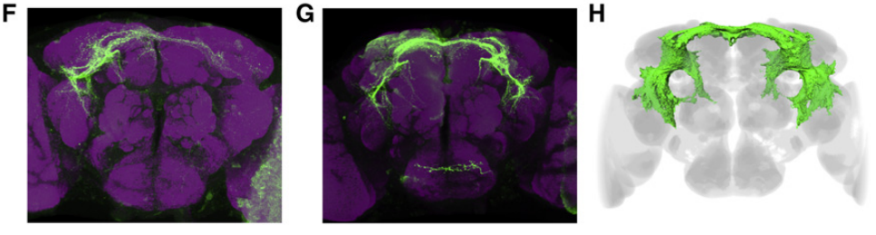
P1 activation does not fix which wing produces song
Laterality refers to the left–right organization of activity or behavior. A brain population that initiates song need not determine which wing performs the vibration. von Philipsborn and colleagues compared unilateral and bilateral P1 activation using stochastic expression.
At the song-inducing temperatures of approximately 30–33 °C, males could extend either the left or the right wing across repeated bouts. Unilateral P1 labeling did not impose a consistent ipsilateral wing choice, and the animals normally avoided simultaneous extension of both wings.
The dissociation places wing selection downstream of, or parallel to, the initiation function attributed to P1. It does not exclude lateralized contributions from individual P1 neurons under natural sensory conditions, because experimental activation recruits a restricted and variable subset of the population.
von Philipsborn et al. (2011), Fig. 2F–H. Unilateral and bilateral P1 labeling and registered P1 anatomy.
von Philipsborn et al. (2011)
21
Notes:
• **Laterality** refers to the left–right organization of activity or behavior. A brain population that initiates song need not determine which wing performs the vibration. von Philipsborn and colleagues compared unilateral and bilateral P1 activation using stochastic expression.
• At the song-inducing temperatures of approximately 30–33 °C, males could extend either the left or the right wing across repeated bouts. Unilateral P1 labeling did not impose a consistent ipsilateral wing choice, and the animals normally avoided simultaneous extension of both wings.
• The dissociation places wing selection downstream of, or parallel to, the initiation function attributed to P1. It does not exclude lateralized contributions from individual P1 neurons under natural sensory conditions, because experimental activation recruits a restricted and variable subset of the population.
References:
von Philipsborn AC, Liu T, Yu JY, Masser C, Bidaye SS, Dickson BJ (2011). Neuronal control of Drosophila courtship song. Neuron 69(3):509–522. https://doi.org/10.1016/j.neuron.2011.01.011
Figure: von Philipsborn et al. (2011), Fig. 2F–H. Unilateral and bilateral P1 labeling and registered P1 anatomy.
Figure source: https://doi.org/10.1016/j.neuron.2011.01.011

Slide 22
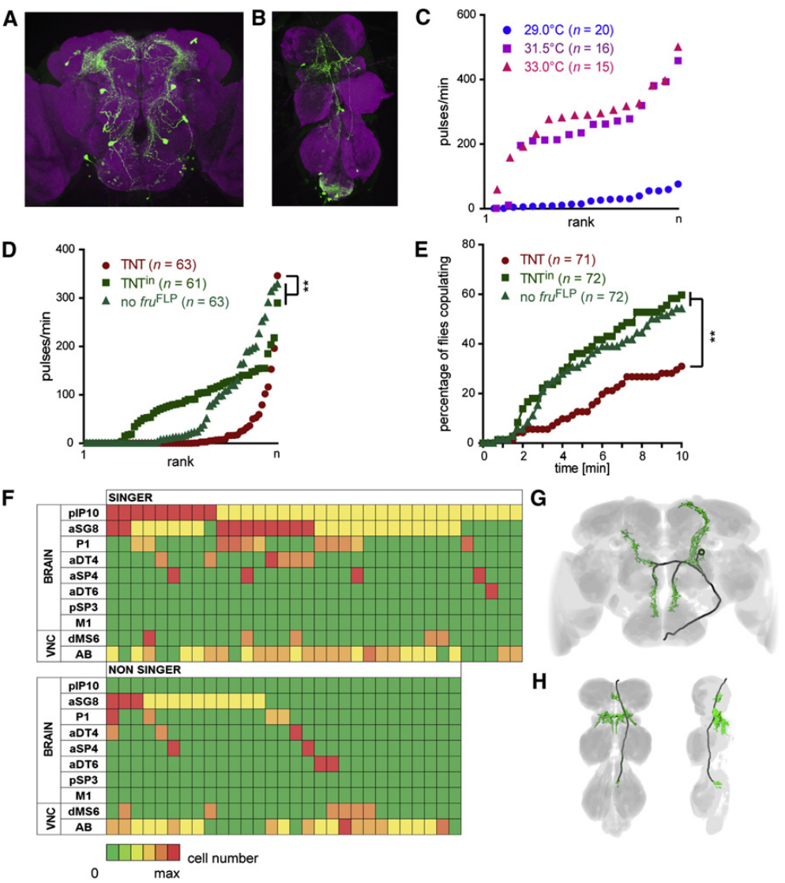
Descending pIP10 neurons link brain and wing circuitry
A descending neuron sends a process from the brain into the nerve cord. The pIP10 class arborizes in brain regions occupied by courtship-related neurons and descends into the anterior mesothoracic wing neuropil, the region containing dense neuronal processes associated with wing control.
Activation of a pIP10-containing genetic pattern elicited natural-like pulse trains. Mean interpulse intervals were approximately 33.3 ms at 29 °C and 35.4 ms at 33 °C, while stochastic labeling associated singing specifically with pIP10 expression.
Synaptic silencing of the broader pattern reduced song and mating. These findings identify a descending route capable of recruiting pulse production, but anatomical overlap with P1 does not independently verify a direct P1-to-pIP10 synapse or exclude other inputs to pIP10.
von Philipsborn et al. (2011), Fig. 3A–H. pIP10-containing anatomy, activation, silencing and neuronal labeling.
von Philipsborn et al. (2011)
22
Notes:
• A **descending neuron** sends a process from the brain into the nerve cord. The pIP10 class arborizes in brain regions occupied by courtship-related neurons and descends into the anterior mesothoracic wing neuropil, the region containing dense neuronal processes associated with wing control.
• Activation of a pIP10-containing genetic pattern elicited natural-like pulse trains. Mean interpulse intervals were approximately 33.3 ms at 29 °C and 35.4 ms at 33 °C, while stochastic labeling associated singing specifically with pIP10 expression.
• Synaptic silencing of the broader pattern reduced song and mating. These findings identify a descending route capable of recruiting pulse production, but anatomical overlap with P1 does not independently verify a direct P1-to-pIP10 synapse or exclude other inputs to pIP10.
References:
von Philipsborn AC, Liu T, Yu JY, Masser C, Bidaye SS, Dickson BJ (2011). Neuronal control of Drosophila courtship song. Neuron 69(3):509–522. https://doi.org/10.1016/j.neuron.2011.01.011
Figure: von Philipsborn et al. (2011), Fig. 3A–H. pIP10-containing anatomy, activation, silencing and neuronal labeling.
Figure source: https://doi.org/10.1016/j.neuron.2011.01.011

Slide 23
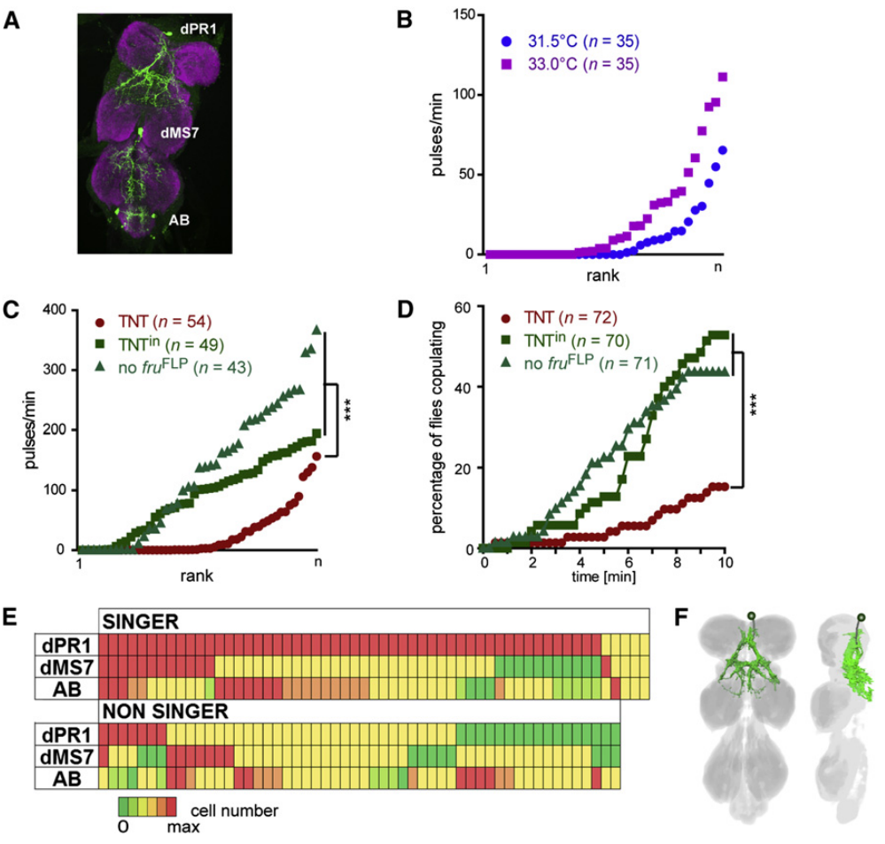
Thoracic dPR1 activation produces prolonged pulse spacing
dPR1 neurons occupy the thoracic nerve cord and extend processes into wing-related neuropil. A restricted expression pattern without labeled brain neurons allowed von Philipsborn and colleagues to test song production from a thoracic population.
Heating TrpA1-expressing males above approximately 31.5 °C elicited pulse trains, but mean interpulse intervals were about 46 ms, longer than natural-like intervals produced by the P1- and pIP10-containing patterns. Stochastic labeling associated bilateral dPR1 expression with singing.
Silenced males could still extend their wings while producing less pulse song, separating wing posture from acoustic patterning. The activation supports a thoracic song-generating contribution, but the driver also labeled other cells, and an artificial temperature stimulus may recruit the network differently from natural descending input.
von Philipsborn et al. (2011), Fig. 4A–F. dPR1-containing anatomy, perturbation and cell labeling.
von Philipsborn et al. (2011)
23
Notes:
• **dPR1 neurons** occupy the thoracic nerve cord and extend processes into wing-related neuropil. A restricted expression pattern without labeled brain neurons allowed von Philipsborn and colleagues to test song production from a thoracic population.
• Heating TrpA1-expressing males above approximately 31.5 °C elicited pulse trains, but mean interpulse intervals were about 46 ms, longer than natural-like intervals produced by the P1- and pIP10-containing patterns. Stochastic labeling associated bilateral dPR1 expression with singing.
• Silenced males could still extend their wings while producing less pulse song, separating wing posture from acoustic patterning. The activation supports a thoracic song-generating contribution, but the driver also labeled other cells, and an artificial temperature stimulus may recruit the network differently from natural descending input.
References:
von Philipsborn AC, Liu T, Yu JY, Masser C, Bidaye SS, Dickson BJ (2011). Neuronal control of Drosophila courtship song. Neuron 69(3):509–522. https://doi.org/10.1016/j.neuron.2011.01.011
Figure: von Philipsborn et al. (2011), Fig. 4A–F. dPR1-containing anatomy, perturbation and cell labeling.
Figure source: https://doi.org/10.1016/j.neuron.2011.01.011

Slide 24
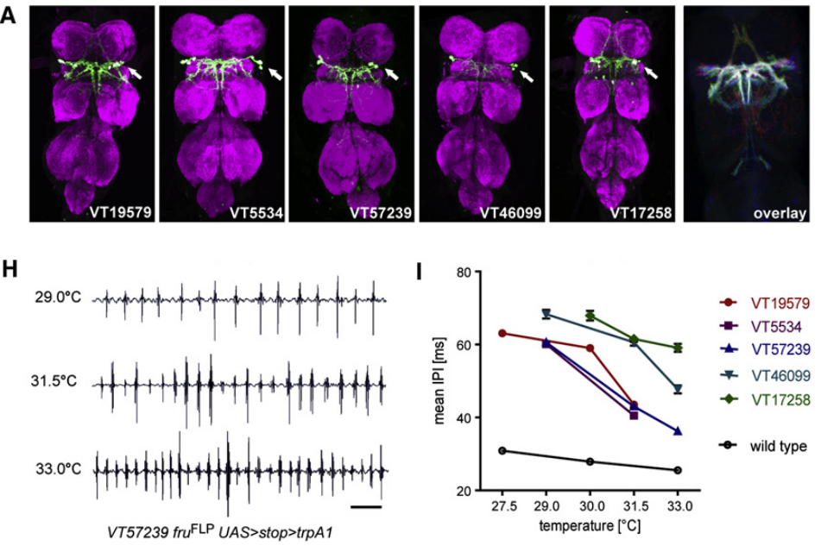
vPR6 activity influences the interval between pulses
vPR6 identifies a thoracic neuronal class with processes in wing neuropil. von Philipsborn and colleagues used several genetic patterns containing this class, testing whether activation changed pulse timing rather than merely triggering an undifferentiated wing movement.
Across five patterns, increasing activation temperature shortened mean interpulse intervals at approximately 5.4–7.0 ms per °C. Wild-type intervals changed by only about 1.0 ms per °C, providing a comparison for the ordinary temperature dependence of song.
The excess shortening was associated with patterns containing vPR6 rather than with every song-promoting pattern. It supports coupling between vPR6 activity and pulse spacing, while leaving unresolved the precise synapses, membrane currents and network dynamics that translate activity into each pulse interval.
von Philipsborn et al. (2011), Fig. 5A,H–I. vPR6 anatomy and activity-dependent interpulse timing.
von Philipsborn et al. (2011)
24
Notes:
• **vPR6** identifies a thoracic neuronal class with processes in wing neuropil. von Philipsborn and colleagues used several genetic patterns containing this class, testing whether activation changed pulse timing rather than merely triggering an undifferentiated wing movement.
• Across five patterns, increasing activation temperature shortened mean interpulse intervals at approximately 5.4–7.0 ms per °C. Wild-type intervals changed by only about 1.0 ms per °C, providing a comparison for the ordinary temperature dependence of song.
• The excess shortening was associated with patterns containing vPR6 rather than with every song-promoting pattern. It supports coupling between vPR6 activity and pulse spacing, while leaving unresolved the precise synapses, membrane currents and network dynamics that translate activity into each pulse interval.
References:
von Philipsborn AC, Liu T, Yu JY, Masser C, Bidaye SS, Dickson BJ (2011). Neuronal control of Drosophila courtship song. Neuron 69(3):509–522. https://doi.org/10.1016/j.neuron.2011.01.011
Figure: von Philipsborn et al. (2011), Fig. 5A,H–I. vPR6 anatomy and activity-dependent interpulse timing.
Figure source: https://doi.org/10.1016/j.neuron.2011.01.011

Slide 25
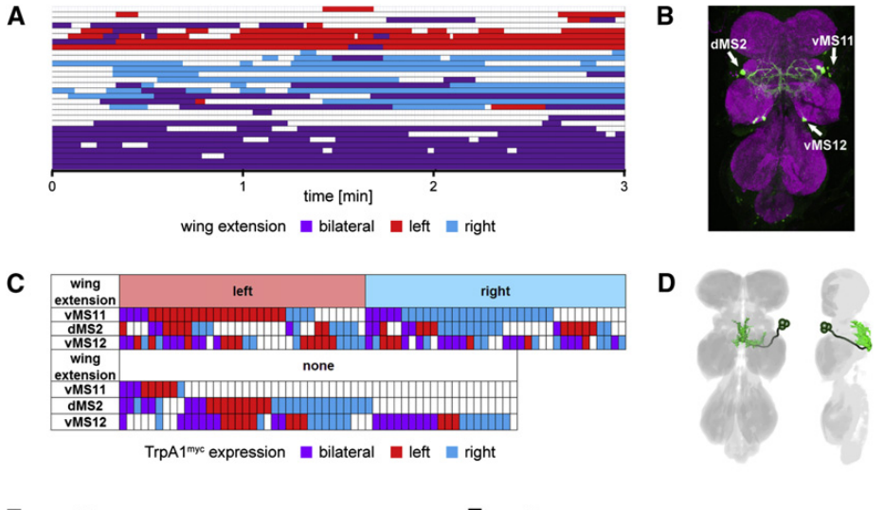
vMS11-containing neurons influence wing selection
vMS11 neurons have cell bodies in the mesothoracic nerve cord and processes in wing-related neuropil. Activation of a pattern containing vMS11 caused wing extension without reliably producing sustained wing vibration.
At approximately 30.5 °C, many males persistently extended one wing across repeated trials, and stochastic expression linked the side of extension with the side of vMS11 labeling. The behavior differed from P1 activation, which permitted either wing to be selected.
Silencing the broader pattern also increased the fraction of pulses containing more than two oscillatory cycles to about 59%, compared with fewer than 3% in controls. Other labeled cells could contribute to this waveform defect; the evidence for wing choice is more cell-specific than the evidence for pulse-shape control.
von Philipsborn et al. (2011), Fig. 6A–D. Wing-use patterns, neuronal labeling and vMS11 anatomy.
von Philipsborn et al. (2011)
25
Notes:
• **vMS11 neurons** have cell bodies in the mesothoracic nerve cord and processes in wing-related neuropil. Activation of a pattern containing vMS11 caused wing extension without reliably producing sustained wing vibration.
• At approximately 30.5 °C, many males persistently extended one wing across repeated trials, and stochastic expression linked the side of extension with the side of vMS11 labeling. The behavior differed from P1 activation, which permitted either wing to be selected.
• Silencing the broader pattern also increased the fraction of pulses containing more than two oscillatory cycles to about 59%, compared with fewer than 3% in controls. Other labeled cells could contribute to this waveform defect; the evidence for wing choice is more cell-specific than the evidence for pulse-shape control.
References:
von Philipsborn AC, Liu T, Yu JY, Masser C, Bidaye SS, Dickson BJ (2011). Neuronal control of Drosophila courtship song. Neuron 69(3):509–522. https://doi.org/10.1016/j.neuron.2011.01.011
Figure: von Philipsborn et al. (2011), Fig. 6A–D. Wing-use patterns, neuronal labeling and vMS11 anatomy.
Figure source: https://doi.org/10.1016/j.neuron.2011.01.011

Slide 26
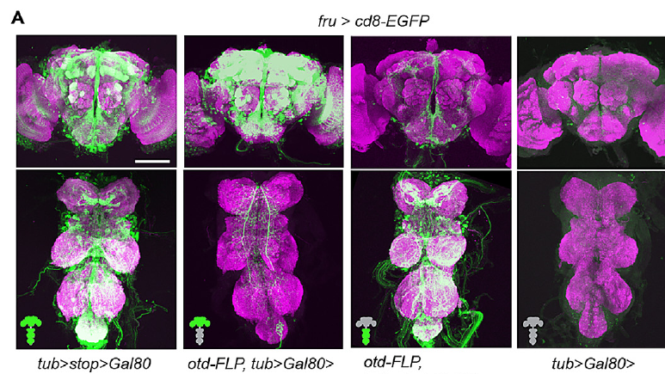
GABA synthesis and reception shape courtship output
GABA, gamma-aminobutyric acid, is an inhibitory neurotransmitter. GAD1, glutamic acid decarboxylase, synthesizes GABA; Rdl is an ionotropic GABA receptor, meaning that transmitter binding directly controls an ion-channel response.
Amin and colleagues reduced GAD1 or Rdl with RNA interference, an RNA-based reduction of the targeted gene’s expression. Anatomical mapping found roughly 220 neurons coexpressing fruitless and GAD1 across brain and nerve cord, rather than one isolated inhibitory cell.
Reducing synthesis limits the available transmitter, while reducing the receptor changes the postsynaptic response to GABA. Both perturbations disrupted courtship motor coordination. These broad manipulations establish a requirement for GABAergic signaling but do not identify every inhibitory connection or its reversal potential.
Amin et al. (2023), Fig. 3A. Brain- and nerve-cord-restricted transgene expression.
Amin et al. (2023)
26
Notes:
• **GABA**, gamma-aminobutyric acid, is an inhibitory neurotransmitter. **GAD1**, glutamic acid decarboxylase, synthesizes GABA; **Rdl** is an ionotropic GABA receptor, meaning that transmitter binding directly controls an ion-channel response.
• Amin and colleagues reduced GAD1 or Rdl with **RNA interference**, an RNA-based reduction of the targeted gene’s expression. Anatomical mapping found roughly 220 neurons coexpressing fruitless and GAD1 across brain and nerve cord, rather than one isolated inhibitory cell.
• Reducing synthesis limits the available transmitter, while reducing the receptor changes the postsynaptic response to GABA. Both perturbations disrupted courtship motor coordination. These broad manipulations establish a requirement for GABAergic signaling but do not identify every inhibitory connection or its reversal potential.
References:
Amin H, Nolte SS, Swain B, von Philipsborn AC (2023). GABAergic signaling shapes multiple aspects of Drosophila courtship motor behavior. iScience 26(11):108069. https://doi.org/10.1016/j.isci.2023.108069
Figure: Amin et al. (2023), Fig. 3A. Brain- and nerve-cord-restricted transgene expression.
Figure source: https://doi.org/10.1016/j.isci.2023.108069

Slide 27
GABA perturbation disrupts unilateral wing extension
Normal D. melanogaster courtship usually uses one extended wing at a time. Amin and colleagues scored wing posture in males with GAD1 or Rdl knockdown in fruitless-positive neurons, using genetic controls to distinguish the targeted perturbation from the expression system.
Many knockdown males extended both wings, whereas controls predominantly extended one. Control pulse trains were organized around 30–35 ms interpulse intervals, but the posture defect was scored separately from the timing and waveform of the sound.
The result supports an inhibitory contribution to the coordination of competing wing movements. It does not establish a uniquely identified left–right inhibitory synapse, and bilateral extension alone cannot explain all acoustic defects because pulse cycles, sine production and mating movements were altered as well.
Amin et al. (2023), Fig. 1G. Bilateral wing extension after GAD1 depletion and unilateral control extension.
Amin et al. (2023)
27
Notes:
• Normal _D. melanogaster_ courtship usually uses one extended wing at a time. Amin and colleagues scored wing posture in males with GAD1 or Rdl knockdown in fruitless-positive neurons, using genetic controls to distinguish the targeted perturbation from the expression system.
• Many knockdown males extended both wings, whereas controls predominantly extended one. Control pulse trains were organized around 30–35 ms interpulse intervals, but the posture defect was scored separately from the timing and waveform of the sound.
• The result supports an inhibitory contribution to the coordination of competing wing movements. It does not establish a uniquely identified left–right inhibitory synapse, and bilateral extension alone cannot explain all acoustic defects because pulse cycles, sine production and mating movements were altered as well.
References:
Amin H, Nolte SS, Swain B, von Philipsborn AC (2023). GABAergic signaling shapes multiple aspects of Drosophila courtship motor behavior. iScience 26(11):108069. https://doi.org/10.1016/j.isci.2023.108069
Figure: Amin et al. (2023), Fig. 1G. Bilateral wing extension after GAD1 depletion and unilateral control extension.
Figure source: https://doi.org/10.1016/j.isci.2023.108069

Slide 28
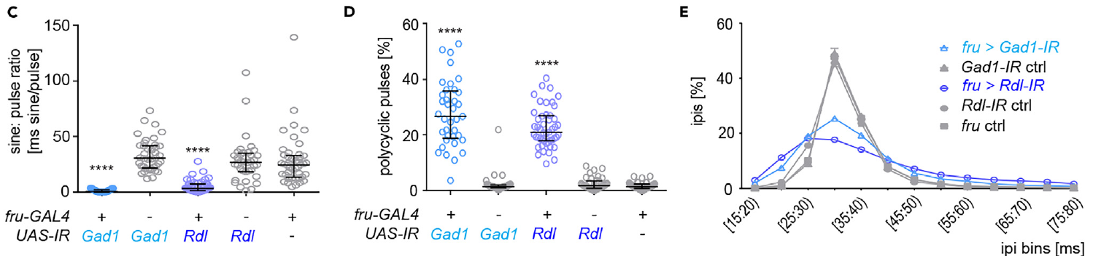
Loss of GABA signaling changes pulse and sine structure
A polycyclic pulse contains more oscillatory cycles than the usual brief pulse waveform. Amin and colleagues compared microphone recordings from GAD1- and Rdl-depleted males with recordings from the corresponding genetic controls.
Knockdown males produced less sine song, more polycyclic pulses and a broader distribution of interpulse intervals. The control distribution concentrated near 30–35 ms; fewer intervals fell in the 30–40 ms range after either perturbation.
The defects concern both the organization of successive pulses and the structure of individual pulses. They support a role for inhibition in shaping the motor pattern, but do not show that a single inhibitory oscillator controls every song property or distinguish all direct effects from compensatory developmental changes.
Amin et al. (2023), Fig. 2C–E. Sine amount, pulse cycles and interpulse interval distributions.
Amin et al. (2023)
28
Notes:
• A **polycyclic pulse** contains more oscillatory cycles than the usual brief pulse waveform. Amin and colleagues compared microphone recordings from GAD1- and Rdl-depleted males with recordings from the corresponding genetic controls.
• Knockdown males produced less sine song, more polycyclic pulses and a broader distribution of interpulse intervals. The control distribution concentrated near 30–35 ms; fewer intervals fell in the 30–40 ms range after either perturbation.
• The defects concern both the organization of successive pulses and the structure of individual pulses. They support a role for inhibition in shaping the motor pattern, but do not show that a single inhibitory oscillator controls every song property or distinguish all direct effects from compensatory developmental changes.
References:
Amin H, Nolte SS, Swain B, von Philipsborn AC (2023). GABAergic signaling shapes multiple aspects of Drosophila courtship motor behavior. iScience 26(11):108069. https://doi.org/10.1016/j.isci.2023.108069
Figure: Amin et al. (2023), Fig. 2C–E. Sine amount, pulse cycles and interpulse interval distributions.
Figure source: https://doi.org/10.1016/j.isci.2023.108069

Slide 29
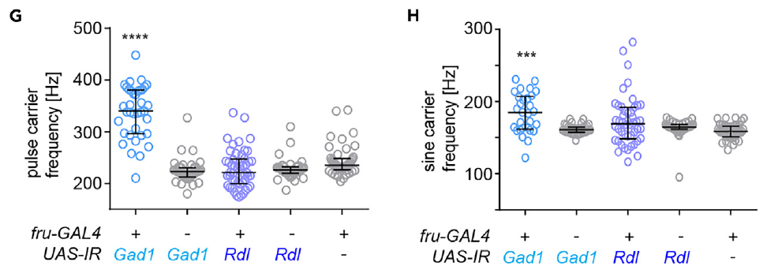
GABA perturbations differ in carrier frequency
The pulse carrier frequency measures oscillations within a pulse, while the sine carrier frequency measures the continuous vibration of sine song. Amin and colleagues quantified both rather than treating the interpulse interval as the frequency of the sound itself.
GAD1 knockdown increased pulse carrier frequency and sine carrier frequency. Rdl knockdown did not reproduce the same frequency shifts, although both perturbations strongly reduced normal sine production. Control pulse carriers occupied approximately the 200–250 Hz range in this preparation.
The difference indicates that reducing GABA synthesis and reducing one receptor do not have identical consequences across the entire circuit. It does not prove a particular receptor compensation mechanism, because the perturbations differ in target, affected cells and residual signaling capacity.
Amin et al. (2023), Fig. 2G–H. Carrier frequencies after GAD1 or Rdl depletion.
Amin et al. (2023)
29
Notes:
• The **pulse carrier frequency** measures oscillations within a pulse, while the **sine carrier frequency** measures the continuous vibration of sine song. Amin and colleagues quantified both rather than treating the interpulse interval as the frequency of the sound itself.
• GAD1 knockdown increased pulse carrier frequency and sine carrier frequency. Rdl knockdown did not reproduce the same frequency shifts, although both perturbations strongly reduced normal sine production. Control pulse carriers occupied approximately the 200–250 Hz range in this preparation.
• The difference indicates that reducing GABA synthesis and reducing one receptor do not have identical consequences across the entire circuit. It does not prove a particular receptor compensation mechanism, because the perturbations differ in target, affected cells and residual signaling capacity.
References:
Amin H, Nolte SS, Swain B, von Philipsborn AC (2023). GABAergic signaling shapes multiple aspects of Drosophila courtship motor behavior. iScience 26(11):108069. https://doi.org/10.1016/j.isci.2023.108069
Figure: Amin et al. (2023), Fig. 2G–H. Carrier frequencies after GAD1 or Rdl depletion.
Figure source: https://doi.org/10.1016/j.isci.2023.108069

Slide 30
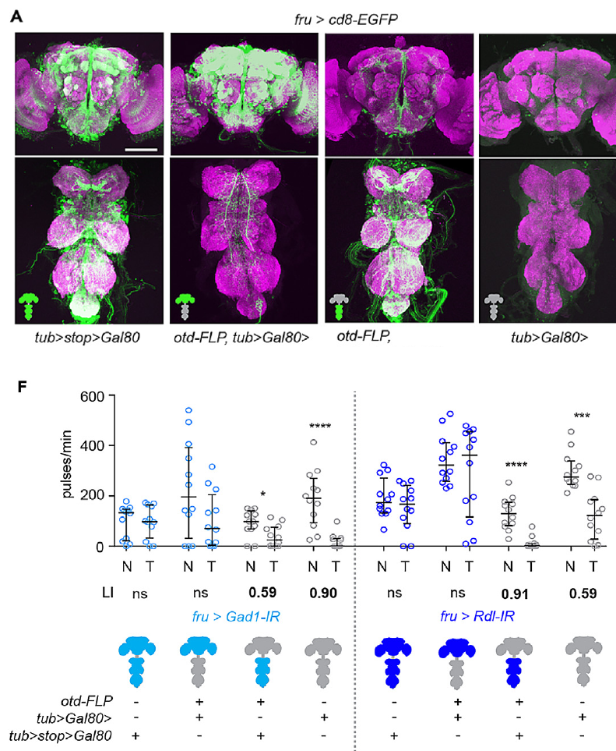
Brain and nerve cord inhibition have distinct functions
Regional restriction separates gene perturbation in the brain from perturbation in the nerve cord. Amin and colleagues used genetic repression and brain-specific recombination, verifying the resulting expression patterns anatomically before interpreting behavior.
Nerve-cord GAD1 or Rdl knockdown recapitulated bilateral wing extension and abnormal song, whereas brain-restricted knockdown did not reproduce those motor defects. Brain knockdown instead impaired courtship conditioning after 1 h of exposure to an unreceptive mated female.
Courtship conditioning is a subsequent reduction in courtship after rejection experience. The regional dissociation supports different inhibitory contributions to motor coordination and experience-dependent suppression. It does not locate a single memory trace or exclude communication between brain and nerve-cord populations during natural courtship.
Amin et al. (2023), Fig. 3A,F. Regional expression and brain versus nerve-cord effects on conditioning.
Amin et al. (2023)
30
Notes:
• **Regional restriction** separates gene perturbation in the brain from perturbation in the nerve cord. Amin and colleagues used genetic repression and brain-specific recombination, verifying the resulting expression patterns anatomically before interpreting behavior.
• Nerve-cord GAD1 or Rdl knockdown recapitulated bilateral wing extension and abnormal song, whereas brain-restricted knockdown did not reproduce those motor defects. Brain knockdown instead impaired courtship conditioning after 1 h of exposure to an unreceptive mated female.
• **Courtship conditioning** is a subsequent reduction in courtship after rejection experience. The regional dissociation supports different inhibitory contributions to motor coordination and experience-dependent suppression. It does not locate a single memory trace or exclude communication between brain and nerve-cord populations during natural courtship.
References:
Amin H, Nolte SS, Swain B, von Philipsborn AC (2023). GABAergic signaling shapes multiple aspects of Drosophila courtship motor behavior. iScience 26(11):108069. https://doi.org/10.1016/j.isci.2023.108069
Figure: Amin et al. (2023), Fig. 3A,F. Regional expression and brain versus nerve-cord effects on conditioning.
Figure source: https://doi.org/10.1016/j.isci.2023.108069

Slide 31
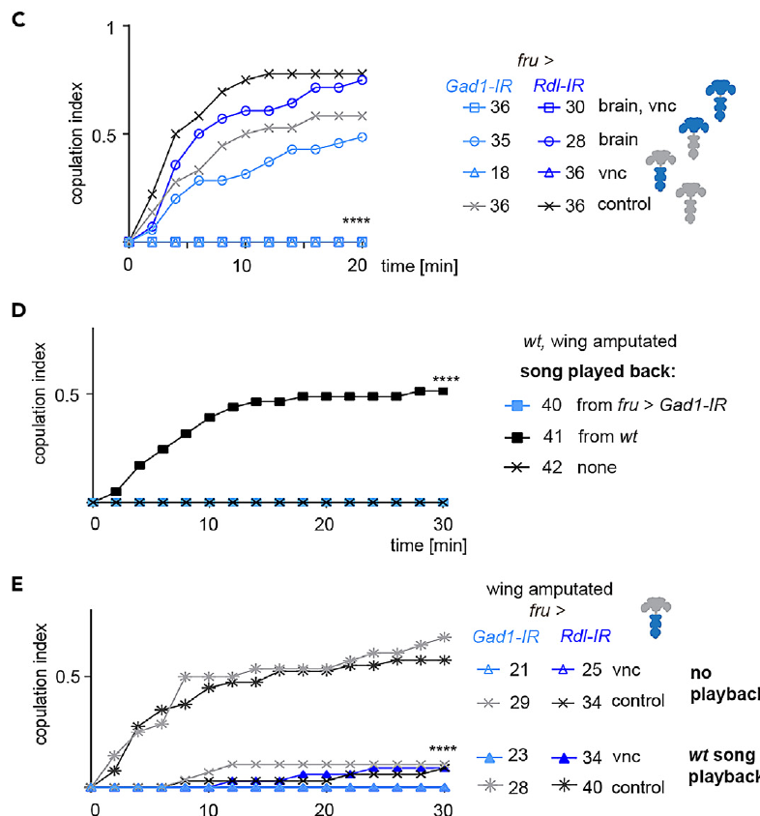
Playback separates song loss from other motor defects
An acoustic playback supplies song without requiring the male to produce it. Amin and colleagues amputated wings and compared mating with normal song playback, abnormal knockdown song playback and no playback.
Normal song improved copulation in wing-amputated control males during the 30 min assay, whereas abnormal song did not provide the same rescue. Supplying normal song to males with nerve-cord GAD1 or Rdl knockdown still failed to restore normal mating success.
The positive control establishes that the playback could compensate for missing wing-generated sound. Failure in the knockdown males therefore implicates additional courtship motor defects, rather than permitting the entire mating impairment to be assigned to reduced song quality alone.
Amin et al. (2023), Fig. 3C–E. Regional mating impairment and acoustic playback controls.
Amin et al. (2023)
31
Notes:
• An **acoustic playback** supplies song without requiring the male to produce it. Amin and colleagues amputated wings and compared mating with normal song playback, abnormal knockdown song playback and no playback.
• Normal song improved copulation in wing-amputated control males during the 30 min assay, whereas abnormal song did not provide the same rescue. Supplying normal song to males with nerve-cord GAD1 or Rdl knockdown still failed to restore normal mating success.
• The positive control establishes that the playback could compensate for missing wing-generated sound. Failure in the knockdown males therefore implicates additional courtship motor defects, rather than permitting the entire mating impairment to be assigned to reduced song quality alone.
References:
Amin H, Nolte SS, Swain B, von Philipsborn AC (2023). GABAergic signaling shapes multiple aspects of Drosophila courtship motor behavior. iScience 26(11):108069. https://doi.org/10.1016/j.isci.2023.108069
Figure: Amin et al. (2023), Fig. 3C–E. Regional mating impairment and acoustic playback controls.
Figure source: https://doi.org/10.1016/j.isci.2023.108069

Slide 32
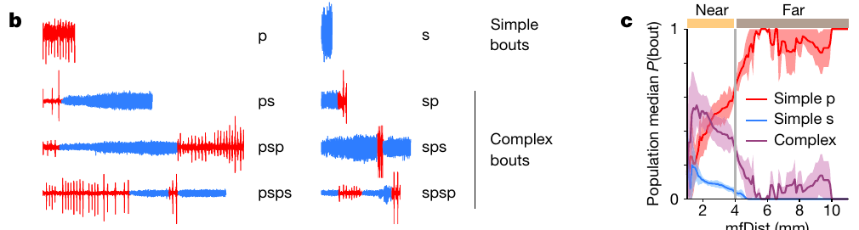
Distance changes the probability of complex song bouts
A simple bout contains one song mode; a complex bout alternates between pulse and sine. Roemschied and colleagues recorded paired flies and classified sequences while retaining the changing distance between male and female.
Using 4 mm to separate near and far interactions, they found that simple pulse bouts comprised more than 95% of far bouts but roughly 55% of near bouts. Complex bouts beginning with pulse contributed about 30% near the female.
The classification exposes context-dependent sequencing within the same two song modes. The 4 mm division is an analytical threshold rather than evidence for an abrupt sensory boundary, and proximity covaries with angle, tapping and other signals exchanged during courtship.
Roemschied et al. (2023), Fig. 1b–c. Song sequences and distance-dependent bout probabilities.
Roemschied et al. (2023)
32
Notes:
• A **simple bout** contains one song mode; a **complex bout** alternates between pulse and sine. Roemschied and colleagues recorded paired flies and classified sequences while retaining the changing distance between male and female.
• Using 4 mm to separate near and far interactions, they found that simple pulse bouts comprised more than 95% of far bouts but roughly 55% of near bouts. Complex bouts beginning with pulse contributed about 30% near the female.
• The classification exposes context-dependent sequencing within the same two song modes. The 4 mm division is an analytical threshold rather than evidence for an abrupt sensory boundary, and proximity covaries with angle, tapping and other signals exchanged during courtship.
References:
Roemschied FA, Pacheco DA, Aragon MJ, Ireland EC, Li X, Thieringer K, Pang R, Murthy M (2023). Flexible circuit mechanisms for context-dependent song sequencing. Nature 622(7984):794–801. https://doi.org/10.1038/s41586-023-06632-1
Figure: Roemschied et al. (2023), Fig. 1b–c. Song sequences and distance-dependent bout probabilities.
Figure source: https://doi.org/10.1038/s41586-023-06632-1

Slide 33
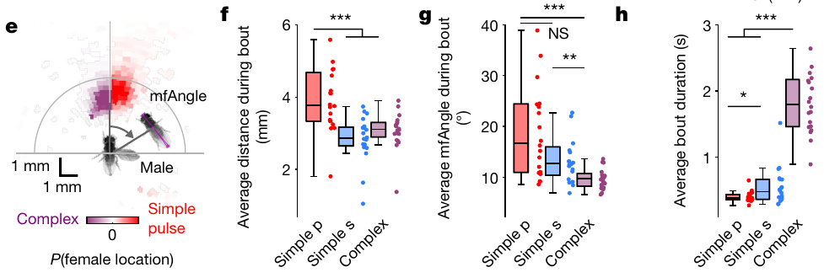
Close frontal interactions favor longer complex bouts
Relative bearing describes the female’s position with respect to the male’s body axis. Roemschied and colleagues compared that position, inter-fly distance and duration across simple pulse, simple sine and complex bouts.
Complex bouts tended to occur when the female was closer and more directly in front of the male. Their duration was longer than that of simple bouts, with the reported distributions spanning approximately 0–3 s.
The relationship connects the organization of song with the geometry of the interaction. It does not establish that angle alone triggers a specific sequence, because close frontal positioning also increases opportunities for contact and changes visual motion, chemical sampling and locomotor state.
Roemschied et al. (2023), Fig. 1e–h. Female position and the duration of simple and complex bouts.
Roemschied et al. (2023)
33
Notes:
• **Relative bearing** describes the female’s position with respect to the male’s body axis. Roemschied and colleagues compared that position, inter-fly distance and duration across simple pulse, simple sine and complex bouts.
• Complex bouts tended to occur when the female was closer and more directly in front of the male. Their duration was longer than that of simple bouts, with the reported distributions spanning approximately 0–3 s.
• The relationship connects the organization of song with the geometry of the interaction. It does not establish that angle alone triggers a specific sequence, because close frontal positioning also increases opportunities for contact and changes visual motion, chemical sampling and locomotor state.
References:
Roemschied FA, Pacheco DA, Aragon MJ, Ireland EC, Li X, Thieringer K, Pang R, Murthy M (2023). Flexible circuit mechanisms for context-dependent song sequencing. Nature 622(7984):794–801. https://doi.org/10.1038/s41586-023-06632-1
Figure: Roemschied et al. (2023), Fig. 1e–h. Female position and the duration of simple and complex bouts.
Figure source: https://doi.org/10.1038/s41586-023-06632-1

Slide 34
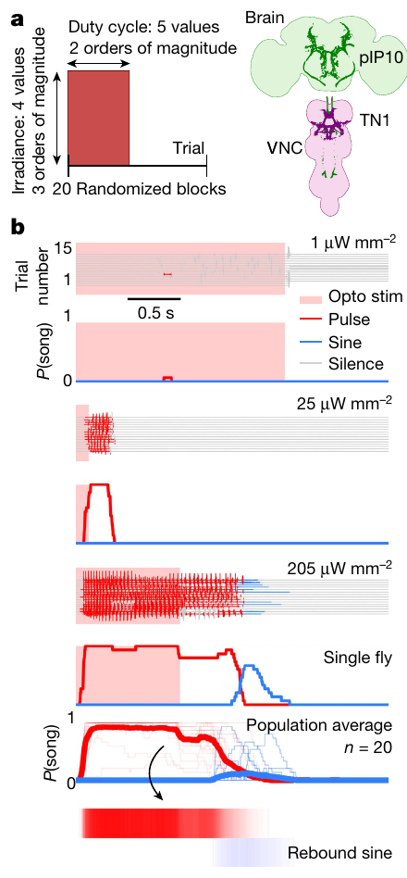
Optogenetic drive can produce delayed sine song
Optogenetics uses a light-sensitive protein to alter neuronal activity. Roemschied and colleagues expressed the red-light-gated cation channel CsChrimson in song-promoting neurons and varied stimulus intensity and duty cycle.
Activation of descending pIP10 in solitary males primarily drove pulse song during stimulation. Strong stimulation could be followed by sine song after light offset; example irradiances ranged from 1 to 205 µW/mm² rather than using only one activation strength.
Rebound activity is activity occurring after removal of a preceding suppressive influence. Delayed sine production is consistent with a rebound-capable network, but the behavioral timing alone does not measure inhibition directly or identify which neuron carries the relevant membrane current.
Roemschied et al. (2023), Fig. 2a–b. Optogenetic protocol and song during and after activation.
Roemschied et al. (2023)
34
Notes:
• **Optogenetics** uses a light-sensitive protein to alter neuronal activity. Roemschied and colleagues expressed the red-light-gated cation channel **CsChrimson** in song-promoting neurons and varied stimulus intensity and duty cycle.
• Activation of descending pIP10 in solitary males primarily drove pulse song during stimulation. Strong stimulation could be followed by sine song after light offset; example irradiances ranged from 1 to 205 µW/mm² rather than using only one activation strength.
• **Rebound activity** is activity occurring after removal of a preceding suppressive influence. Delayed sine production is consistent with a rebound-capable network, but the behavioral timing alone does not measure inhibition directly or identify which neuron carries the relevant membrane current.
References:
Roemschied FA, Pacheco DA, Aragon MJ, Ireland EC, Li X, Thieringer K, Pang R, Murthy M (2023). Flexible circuit mechanisms for context-dependent song sequencing. Nature 622(7984):794–801. https://doi.org/10.1038/s41586-023-06632-1
Figure: Roemschied et al. (2023), Fig. 2a–b. Optogenetic protocol and song during and after activation.
Figure source: https://doi.org/10.1038/s41586-023-06632-1

Slide 35
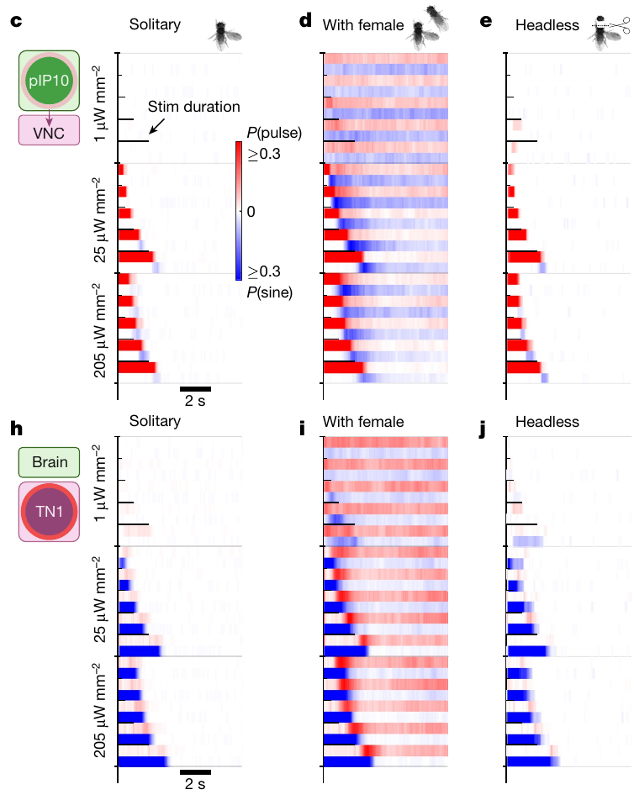
Female context changes the response to descending drive
A fixed neural stimulation can produce different outputs depending on the animal’s context. Roemschied and colleagues activated pIP10 in solitary males, males paired with a female and headless males, comparing song during and after the same stimulation protocol.
Stimulus duration was varied over an 8 s range. Female-paired males produced longer and more reliable complex bouts than solitary males. Headless males could still produce rebound sine, placing a sufficient rebound-generating mechanism within the nerve cord.
The contrast supports modulation of thoracic circuitry by signals associated with a female. Headless output establishes a retained local capacity under artificial activation; it does not establish that the intact brain is dispensable for natural initiation, partner tracking or normal courtship sequencing.
Roemschied et al. (2023), Fig. 2c–e,h–j. pIP10 and TN1 activation in solitary, paired and headless males.
Roemschied et al. (2023)
35
Notes:
• A fixed neural stimulation can produce different outputs depending on the animal’s context. Roemschied and colleagues activated pIP10 in solitary males, males paired with a female and headless males, comparing song during and after the same stimulation protocol.
• Stimulus duration was varied over an 8 s range. Female-paired males produced longer and more reliable complex bouts than solitary males. Headless males could still produce rebound sine, placing a sufficient rebound-generating mechanism within the nerve cord.
• The contrast supports modulation of thoracic circuitry by signals associated with a female. Headless output establishes a retained local capacity under artificial activation; it does not establish that the intact brain is dispensable for natural initiation, partner tracking or normal courtship sequencing.
References:
Roemschied FA, Pacheco DA, Aragon MJ, Ireland EC, Li X, Thieringer K, Pang R, Murthy M (2023). Flexible circuit mechanisms for context-dependent song sequencing. Nature 622(7984):794–801. https://doi.org/10.1038/s41586-023-06632-1
Figure: Roemschied et al. (2023), Fig. 2c–e,h–j. pIP10 and TN1 activation in solitary, paired and headless males.
Figure source: https://doi.org/10.1038/s41586-023-06632-1

Slide 36
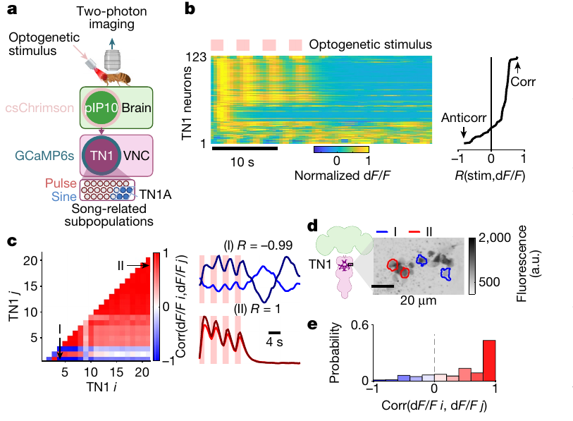
TN1 populations contain opposing activity dynamics
TN1 neurons form a heterogeneous thoracic population associated with wing neuropil. Roemschied and colleagues combined pIP10 optogenetic stimulation with two-photon imaging of a calcium-sensitive fluorescent protein in TN1 neurons.
Individual neurons responded differently to repeated stimulation: some calcium signals tracked the stimulus, whereas others were anticorrelated and peaked after stimulus removal. The recordings retained response timing over seconds and anatomical locations with a 20 µm scale.
Calcium imaging reports changes in intracellular calcium through fluorescence, rather than measuring membrane voltage directly. Opposing response dynamics support functional subdivisions within TN1, but anticorrelation does not independently prove that the recorded cells inhibit each other through direct reciprocal synapses.
Roemschied et al. (2023), Fig. 3a–e. The recording preparation and diverse TN1 calcium dynamics.
Roemschied et al. (2023)
36
Notes:
• **TN1 neurons** form a heterogeneous thoracic population associated with wing neuropil. Roemschied and colleagues combined pIP10 optogenetic stimulation with two-photon imaging of a calcium-sensitive fluorescent protein in TN1 neurons.
• Individual neurons responded differently to repeated stimulation: some calcium signals tracked the stimulus, whereas others were anticorrelated and peaked after stimulus removal. The recordings retained response timing over seconds and anatomical locations with a 20 µm scale.
• **Calcium imaging** reports changes in intracellular calcium through fluorescence, rather than measuring membrane voltage directly. Opposing response dynamics support functional subdivisions within TN1, but anticorrelation does not independently prove that the recorded cells inhibit each other through direct reciprocal synapses.
References:
Roemschied FA, Pacheco DA, Aragon MJ, Ireland EC, Li X, Thieringer K, Pang R, Murthy M (2023). Flexible circuit mechanisms for context-dependent song sequencing. Nature 622(7984):794–801. https://doi.org/10.1038/s41586-023-06632-1
Figure: Roemschied et al. (2023), Fig. 3a–e. The recording preparation and diverse TN1 calcium dynamics.
Figure source: https://doi.org/10.1038/s41586-023-06632-1

Slide 37
Ih and GABA reception contribute to complex sequencing
Ih is a hyperpolarization-activated cation current that can facilitate renewed excitability after inhibition. Hyperpolarization makes the membrane potential more negative; activation of such a current can oppose that change and contribute to rebound after the inhibitory input ends.
Roemschied and colleagues found that males lacking Ih sang predominantly simple pulse bouts even near a female. Reducing Ih or the GABA receptor Rdl in TN1 neurons also reduced complexity, complementing second-scale calcium responses after pIP10 stimulation.
The convergence supports an inhibitory and rebound contribution to sequencing. The exact inhibitory intermediary neurons were proposed rather than identified conclusively, and a channel requirement does not imply that one membrane current alone generates every pulse–sine transition.
Roemschied et al. (2023), Fig. 3a–e. The recording preparation and diverse TN1 calcium dynamics.
Roemschied et al. (2023); Amin et al. (2023)
37
Notes:
• **Ih** is a hyperpolarization-activated cation current that can facilitate renewed excitability after inhibition. **Hyperpolarization** makes the membrane potential more negative; activation of such a current can oppose that change and contribute to rebound after the inhibitory input ends.
• Roemschied and colleagues found that males lacking Ih sang predominantly simple pulse bouts even near a female. Reducing Ih or the GABA receptor Rdl in TN1 neurons also reduced complexity, complementing second-scale calcium responses after pIP10 stimulation.
• The convergence supports an inhibitory and rebound contribution to sequencing. The exact inhibitory intermediary neurons were proposed rather than identified conclusively, and a channel requirement does not imply that one membrane current alone generates every pulse–sine transition.
References:
Roemschied FA, Pacheco DA, Aragon MJ, Ireland EC, Li X, Thieringer K, Pang R, Murthy M (2023). Flexible circuit mechanisms for context-dependent song sequencing. Nature 622(7984):794–801. https://doi.org/10.1038/s41586-023-06632-1
Amin H, Nolte SS, Swain B, von Philipsborn AC (2023). GABAergic signaling shapes multiple aspects of Drosophila courtship motor behavior. iScience 26(11):108069. https://doi.org/10.1016/j.isci.2023.108069
Figure: Roemschied et al. (2023), Fig. 3a–e. The recording preparation and diverse TN1 calcium dynamics.
Figure source: https://doi.org/10.1038/s41586-023-06632-1

Slide 38
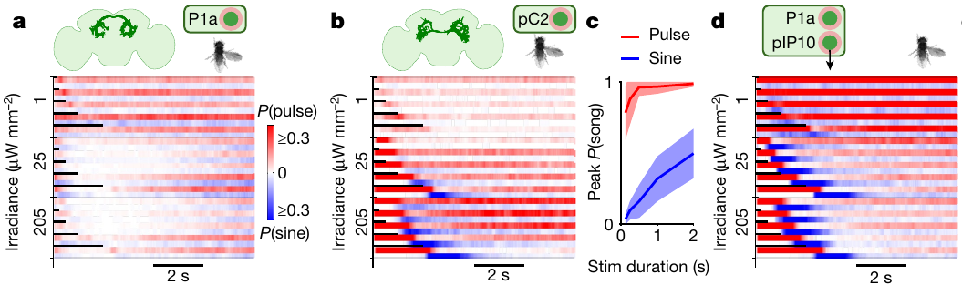
Sensory input and courtship state interact in song control
pC2 neurons integrate visual and auditory signals, while P1a is a courtship-related subset of P1 neurons. Roemschied and colleagues activated these populations separately and together with descending pIP10 to examine how brain input changes song sequencing.
Joint P1a and pIP10 activation produced long complex bouts beyond those obtained from either population alone. pC2 activation could produce pulse followed by rebound sine, and longer stimulation increased rebound output over stimulus durations up to approximately 2 s.
The authors proposed functional disinhibition of a rebound-capable nerve-cord network. Disinhibition reduces an inhibitory influence on another element. The combined activation supports interaction between brain pathways, but the proposed inhibitory implementation remains distinct from direct identification of every intervening synapse.
Roemschied et al. (2023), Fig. 4a–d. P1a, pC2 and combined P1a–pIP10 stimulation affect song sequencing.
Roemschied et al. (2023)
38
Notes:
• **pC2 neurons** integrate visual and auditory signals, while **P1a** is a courtship-related subset of P1 neurons. Roemschied and colleagues activated these populations separately and together with descending pIP10 to examine how brain input changes song sequencing.
• Joint P1a and pIP10 activation produced long complex bouts beyond those obtained from either population alone. pC2 activation could produce pulse followed by rebound sine, and longer stimulation increased rebound output over stimulus durations up to approximately 2 s.
• The authors proposed functional disinhibition of a rebound-capable nerve-cord network. **Disinhibition** reduces an inhibitory influence on another element. The combined activation supports interaction between brain pathways, but the proposed inhibitory implementation remains distinct from direct identification of every intervening synapse.
References:
Roemschied FA, Pacheco DA, Aragon MJ, Ireland EC, Li X, Thieringer K, Pang R, Murthy M (2023). Flexible circuit mechanisms for context-dependent song sequencing. Nature 622(7984):794–801. https://doi.org/10.1038/s41586-023-06632-1
Figure: Roemschied et al. (2023), Fig. 4a–d. P1a, pC2 and combined P1a–pIP10 stimulation affect song sequencing.
Figure source: https://doi.org/10.1038/s41586-023-06632-1

Slide 39
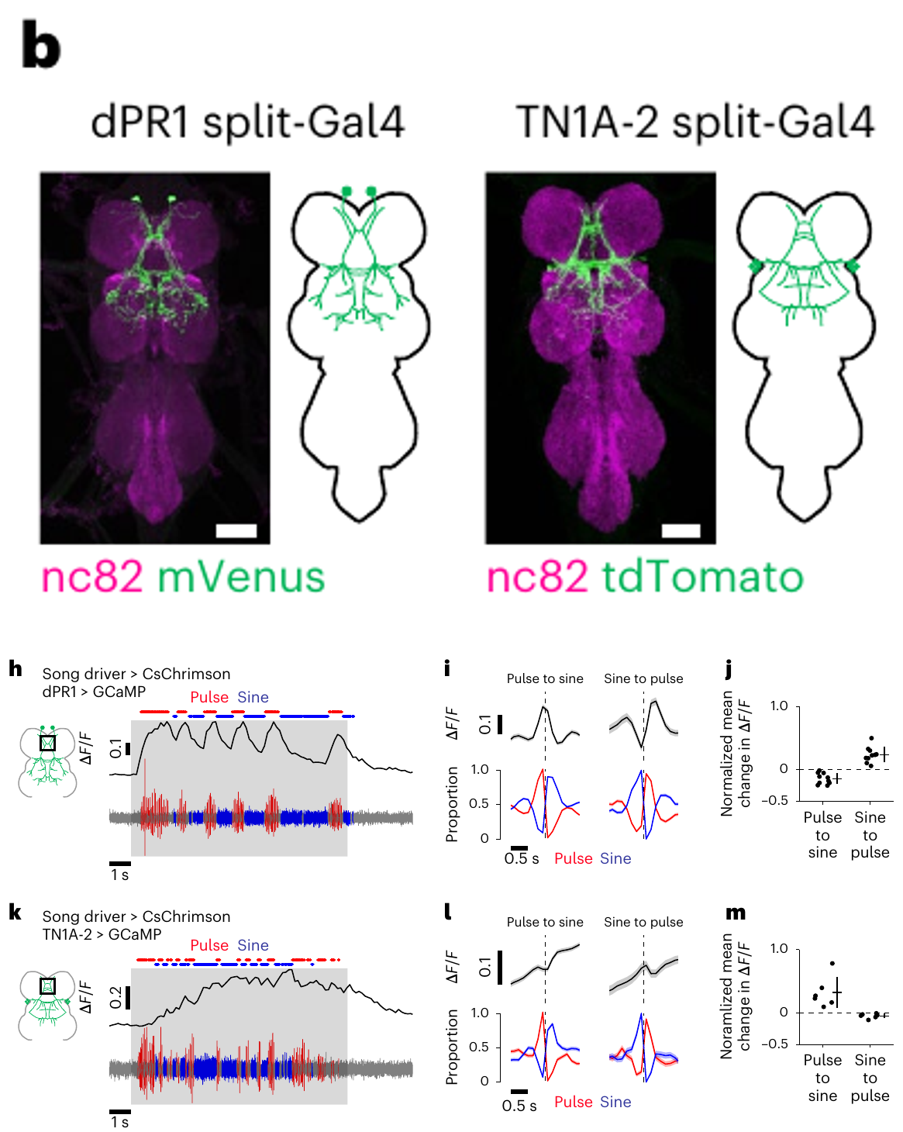
Singing engages nested rather than disjoint populations
Nested activation means that one active population includes another as a subset. Shiozaki and colleagues imaged identified nerve-cord neurons while flies alternated pulse and sine, preserving wing vibration by attaching parts of the legs instead of immobilizing the thorax.
dPR1 calcium signals preferred pulse and declined during sine. TN1A-2 signals remained active during both modes, with stronger activity during sine. Response changes were aligned around transitions on a 0.5 s timescale rather than inferred solely from activation-induced song.
The observations support shared circuit participation with an additional pulse-related population. They challenge a simple picture of two completely separate inactive-versus-active populations, but fluorescence measurements do not exclude inhibitory interactions or resolve the precise spike pattern within each individual pulse.
Shiozaki et al. (2024), Fig. 1b,h–m. dPR1 and TN1A-2 anatomy and calcium signals across song types.
Shiozaki et al. (2024)
39
Notes:
• **Nested activation** means that one active population includes another as a subset. Shiozaki and colleagues imaged identified nerve-cord neurons while flies alternated pulse and sine, preserving wing vibration by attaching parts of the legs instead of immobilizing the thorax.
• dPR1 calcium signals preferred pulse and declined during sine. TN1A-2 signals remained active during both modes, with stronger activity during sine. Response changes were aligned around transitions on a 0.5 s timescale rather than inferred solely from activation-induced song.
• The observations support shared circuit participation with an additional pulse-related population. They challenge a simple picture of two completely separate inactive-versus-active populations, but fluorescence measurements do not exclude inhibitory interactions or resolve the precise spike pattern within each individual pulse.
References:
Shiozaki HM, Wang K, Lillvis JL, Xu M, Dickson BJ, Stern DL (2024). Activity of nested neural circuits drives different courtship songs in Drosophila. Nature Neuroscience 27(10):1954–1965. https://doi.org/10.1038/s41593-024-01738-9
Figure: Shiozaki et al. (2024), Fig. 1b,h–m. dPR1 and TN1A-2 anatomy and calcium signals across song types.
Figure source: https://doi.org/10.1038/s41593-024-01738-9

Slide 40
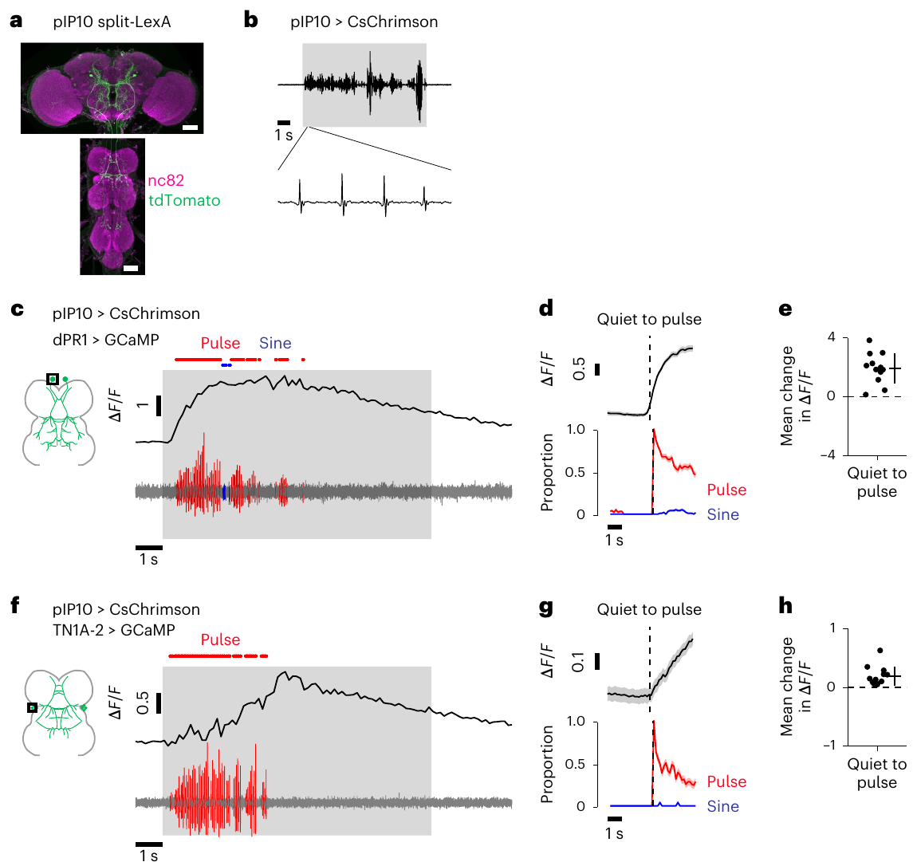
pIP10 recruits both pulse- and sine-associated neurons
Descending input can recruit a shared thoracic population even when the behavioral output is predominantly pulse. Shiozaki and colleagues activated pIP10 with CsChrimson while measuring calcium in dPR1 and TN1A-2.
Both populations increased calcium signals during pIP10-induced pulse song. The source recordings retain a 1 s scale and neuronal labeling, linking the evoked sound to measured activity in anatomically identified nerve-cord classes.
TN1A-2 activity during pulse is therefore not evidence that sine must also be audible at that moment. A neuron capable of promoting one mode when artificially activated can participate in another mode within the intact network; sufficiency experiments and natural activity require separate interpretation.
Shiozaki et al. (2024), Fig. 2a–h. Nerve cord responses during pIP10-driven pulse song.
Shiozaki et al. (2024)
40
Notes:
• Descending input can recruit a shared thoracic population even when the behavioral output is predominantly pulse. Shiozaki and colleagues activated pIP10 with CsChrimson while measuring calcium in dPR1 and TN1A-2.
• Both populations increased calcium signals during pIP10-induced pulse song. The source recordings retain a 1 s scale and neuronal labeling, linking the evoked sound to measured activity in anatomically identified nerve-cord classes.
• TN1A-2 activity during pulse is therefore not evidence that sine must also be audible at that moment. A neuron capable of promoting one mode when artificially activated can participate in another mode within the intact network; sufficiency experiments and natural activity require separate interpretation.
References:
Shiozaki HM, Wang K, Lillvis JL, Xu M, Dickson BJ, Stern DL (2024). Activity of nested neural circuits drives different courtship songs in Drosophila. Nature Neuroscience 27(10):1954–1965. https://doi.org/10.1038/s41593-024-01738-9
Figure: Shiozaki et al. (2024), Fig. 2a–h. Nerve cord responses during pIP10-driven pulse song.
Figure source: https://doi.org/10.1038/s41593-024-01738-9

Slide 41
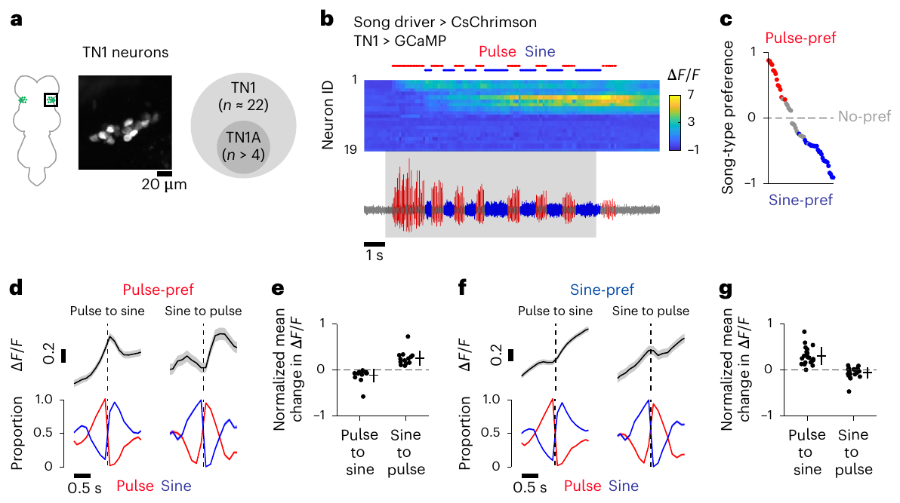
Song preferences differ across the TN1 population
A heterogeneous neuronal class can contain subpopulations with different activity preferences. Shiozaki and colleagues imaged broader TN1 populations during alternating song, comparing calcium signals aligned to the transitions between pulse and sine.
The sampled nerve-cord region contains approximately 22 TN1 neurons per hemisphere. Pulse-preferring neurons decreased their signals during sine, whereas sine-preferring neurons remained active during pulse as well. Transition analyses retained a 0.5 s timescale.
The asymmetry extends nested participation beyond one labeled pair of classes. It does not make every TN1 neuron functionally identical, and limited temporal resolution means that shared calcium elevation can conceal differences in spike timing, transmitter release and the strength of each neuron’s contribution to wing muscles.
Shiozaki et al. (2024), Fig. 3a–g. TN1 population activity and song preferences.
Shiozaki et al. (2024)
41
Notes:
• A heterogeneous neuronal class can contain subpopulations with different activity preferences. Shiozaki and colleagues imaged broader TN1 populations during alternating song, comparing calcium signals aligned to the transitions between pulse and sine.
• The sampled nerve-cord region contains approximately 22 TN1 neurons per hemisphere. Pulse-preferring neurons decreased their signals during sine, whereas sine-preferring neurons remained active during pulse as well. Transition analyses retained a 0.5 s timescale.
• The asymmetry extends nested participation beyond one labeled pair of classes. It does not make every TN1 neuron functionally identical, and limited temporal resolution means that shared calcium elevation can conceal differences in spike timing, transmitter release and the strength of each neuron’s contribution to wing muscles.
References:
Shiozaki HM, Wang K, Lillvis JL, Xu M, Dickson BJ, Stern DL (2024). Activity of nested neural circuits drives different courtship songs in Drosophila. Nature Neuroscience 27(10):1954–1965. https://doi.org/10.1038/s41593-024-01738-9
Figure: Shiozaki et al. (2024), Fig. 3a–g. TN1 population activity and song preferences.
Figure source: https://doi.org/10.1038/s41593-024-01738-9

Slide 42
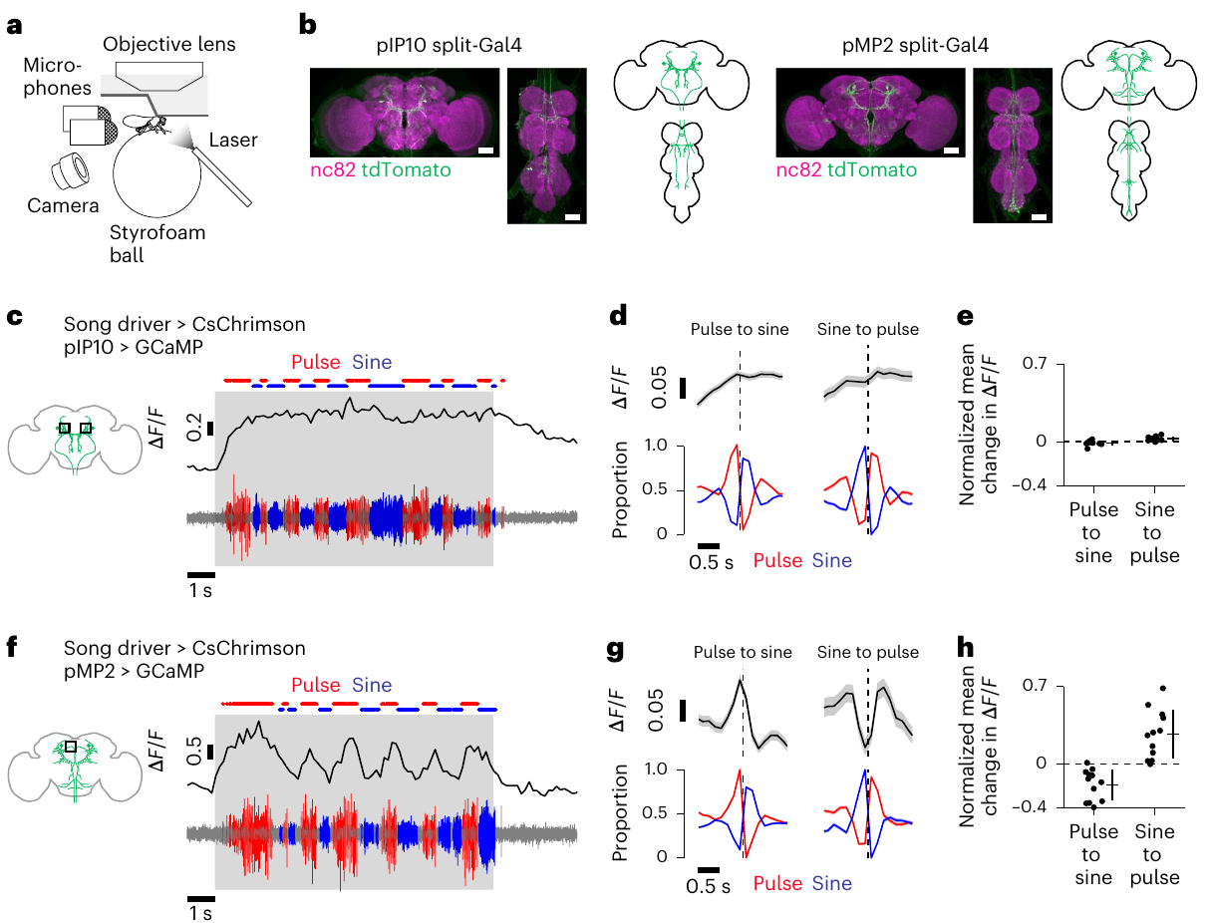
Descending pathways differ in song dynamics
pMP2 is another descending neuron class connecting brain and nerve cord. Shiozaki and colleagues compared its activity with pIP10 while recording song and calcium signals from the brain during alternating pulse and sine.
pIP10 remained active during both song modes, whereas pMP2 showed pulse-selective activity that increased at sine-to-pulse transitions and declined at pulse-to-sine transitions. The aligned measurements retain a 0.5 s transition scale and labeled descending anatomy.
The findings support differential input to the thoracic network rather than a single constant descending command for every song mode. They do not establish that either pathway exclusively determines behavior, because sensory context, other descending neurons and the ongoing nerve-cord state remain available to influence the output.
Shiozaki et al. (2024), Fig. 6a–h. Parallel descending pathways have different song-related calcium dynamics.
Shiozaki et al. (2024)
42
Notes:
• **pMP2** is another descending neuron class connecting brain and nerve cord. Shiozaki and colleagues compared its activity with pIP10 while recording song and calcium signals from the brain during alternating pulse and sine.
• pIP10 remained active during both song modes, whereas pMP2 showed pulse-selective activity that increased at sine-to-pulse transitions and declined at pulse-to-sine transitions. The aligned measurements retain a 0.5 s transition scale and labeled descending anatomy.
• The findings support differential input to the thoracic network rather than a single constant descending command for every song mode. They do not establish that either pathway exclusively determines behavior, because sensory context, other descending neurons and the ongoing nerve-cord state remain available to influence the output.
References:
Shiozaki HM, Wang K, Lillvis JL, Xu M, Dickson BJ, Stern DL (2024). Activity of nested neural circuits drives different courtship songs in Drosophila. Nature Neuroscience 27(10):1954–1965. https://doi.org/10.1038/s41593-024-01738-9
Figure: Shiozaki et al. (2024), Fig. 6a–h. Parallel descending pathways have different song-related calcium dynamics.
Figure source: https://doi.org/10.1038/s41593-024-01738-9

Slide 43
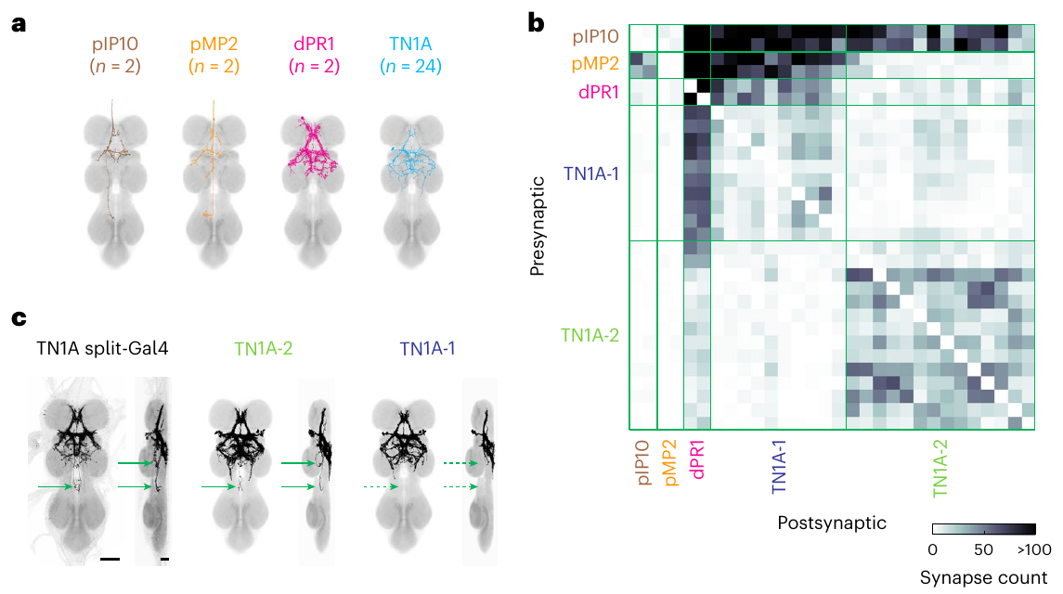
Connectomics distinguishes shared and selective inputs
Connectomics reconstructs neurons and their synaptic contacts from electron microscopy. Shiozaki and colleagues matched descending and thoracic song-related classes to reconstructed neurons, separating TN1A into two connectivity-defined subgroups.
pIP10 and pMP2 provided inputs to pulse-associated dPR1 and TN1A-1 neurons, whereas TN1A-2 had different input relationships. The reconstructed anatomy preserves a 50 µm scale, and synapse counts quantify contacts rather than relying on light-microscopic arbor overlap.
These neurons were classified as cholinergic and therefore likely excitatory. Acetylcholine is the transmitter indicated by that classification; actual effect still depends on the postsynaptic receptor. Structural contacts strengthen a circuit account but do not alone measure synaptic efficacy, receptor subtype or activity during each song transition.
Shiozaki et al. (2024), Fig. 8a–c. Electron-microscopy reconstructions and song-circuit synaptic connectivity.
Shiozaki et al. (2024)
43
Notes:
• **Connectomics** reconstructs neurons and their synaptic contacts from electron microscopy. Shiozaki and colleagues matched descending and thoracic song-related classes to reconstructed neurons, separating TN1A into two connectivity-defined subgroups.
• pIP10 and pMP2 provided inputs to pulse-associated dPR1 and TN1A-1 neurons, whereas TN1A-2 had different input relationships. The reconstructed anatomy preserves a 50 µm scale, and synapse counts quantify contacts rather than relying on light-microscopic arbor overlap.
• These neurons were classified as cholinergic and therefore likely excitatory. **Acetylcholine** is the transmitter indicated by that classification; actual effect still depends on the postsynaptic receptor. Structural contacts strengthen a circuit account but do not alone measure synaptic efficacy, receptor subtype or activity during each song transition.
References:
Shiozaki HM, Wang K, Lillvis JL, Xu M, Dickson BJ, Stern DL (2024). Activity of nested neural circuits drives different courtship songs in Drosophila. Nature Neuroscience 27(10):1954–1965. https://doi.org/10.1038/s41593-024-01738-9
Figure: Shiozaki et al. (2024), Fig. 8a–c. Electron-microscopy reconstructions and song-circuit synaptic connectivity.
Figure source: https://doi.org/10.1038/s41593-024-01738-9

Slide 44
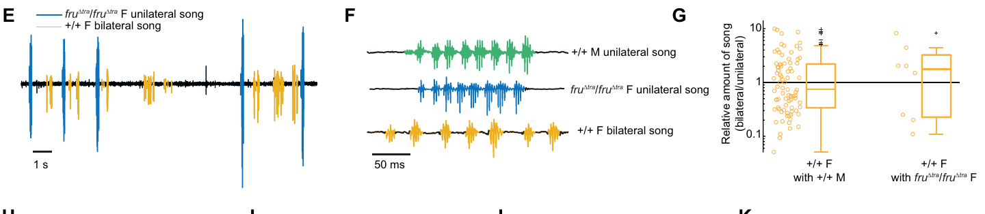
Fruitless-dependent song differs across Drosophila species
Comparative analysis tests whether a mechanism retains the same behavioral consequences in different species. Baker and colleagues forced male-specific fruitless splicing in Drosophila virilis females using CRISPR-mediated removal of Transformer-binding sequences.
Two modified alleles were required for male-typical unilateral song, whereas one allele suffices for broad male-like courtship in D. melanogaster females. D. virilis song recordings distinguish unilateral and bilateral signals with a 50 ms waveform scale.
Engineered D. virilis females produced male-typical song in only a subset of pairings and at much lower total amounts than males. A conserved transcription factor therefore does not guarantee identical dosage requirements or a complete behavioral conversion across species.
Baker et al. (2024), Fig. 2E–G. Unilateral and bilateral song recordings and the relative amount of song.
Baker et al. (2024); Demir & Dickson (2005)
44
Notes:
• **Comparative analysis** tests whether a mechanism retains the same behavioral consequences in different species. Baker and colleagues forced male-specific fruitless splicing in _Drosophila virilis_ females using CRISPR-mediated removal of Transformer-binding sequences.
• Two modified alleles were required for male-typical unilateral song, whereas one allele suffices for broad male-like courtship in _D. melanogaster_ females. _D. virilis_ song recordings distinguish unilateral and bilateral signals with a 50 ms waveform scale.
• Engineered _D. virilis_ females produced male-typical song in only a subset of pairings and at much lower total amounts than males. A conserved transcription factor therefore does not guarantee identical dosage requirements or a complete behavioral conversion across species.
References:
Baker CA, Guan XJ, Choi M, Murthy M (2024). The role of fruitless in specifying courtship behaviors across divergent Drosophila species. Science Advances 10(11):eadk1273. https://doi.org/10.1126/sciadv.adk1273
Demir E, Dickson BJ (2005). fruitless splicing specifies male courtship behavior in Drosophila. Cell 121(5):785–794. https://doi.org/10.1016/j.cell.2005.04.027
Figure: Baker et al. (2024), Fig. 2E–G. Unilateral and bilateral song recordings and the relative amount of song.
Figure source: https://doi.org/10.1126/sciadv.adk1273

Slide 45
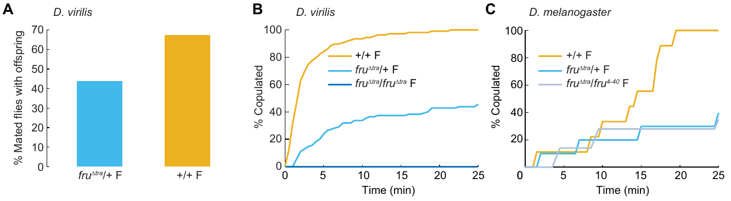
FruM effects on female reproduction differ by species
Genetic background includes the other genes and regulatory relationships in which a manipulation acts. Baker and colleagues compared mating and reproductive outcomes of FruM-expressing females in D. virilis and D. melanogaster.
D. virilis females carrying one modified allele retained egg laying and could produce offspring after mating. Their copulation rate during the 25 min assay was about 40% of the wild-type rate; two modified alleles eliminated copulation within that interval.
These outcomes differ from the strong suppression of egg laying in engineered D. melanogaster females. The comparison limits a universal binary-switch interpretation of fruitless: effects on male song, female receptivity and fertility depend on species, allele dosage and the behavior being measured.
Baker et al. (2024), Fig. 3A–C. Reproductive outcomes of FruM-expressing females in two species.
Baker et al. (2024)
45
Notes:
• **Genetic background** includes the other genes and regulatory relationships in which a manipulation acts. Baker and colleagues compared mating and reproductive outcomes of FruM-expressing females in _D. virilis_ and _D. melanogaster_.
• _D. virilis_ females carrying one modified allele retained egg laying and could produce offspring after mating. Their copulation rate during the 25 min assay was about 40% of the wild-type rate; two modified alleles eliminated copulation within that interval.
• These outcomes differ from the strong suppression of egg laying in engineered _D. melanogaster_ females. The comparison limits a universal binary-switch interpretation of fruitless: effects on male song, female receptivity and fertility depend on species, allele dosage and the behavior being measured.
References:
Baker CA, Guan XJ, Choi M, Murthy M (2024). The role of fruitless in specifying courtship behaviors across divergent Drosophila species. Science Advances 10(11):eadk1273. https://doi.org/10.1126/sciadv.adk1273
Figure: Baker et al. (2024), Fig. 3A–C. Reproductive outcomes of FruM-expressing females in two species.
Figure source: https://doi.org/10.1126/sciadv.adk1273

Slide 46
Key takeaways
Song dimensions include pulse–sine mode, carrier frequency and interpulse timing; movement and partner context change their expression.
fruitless development uses sex-specific splicing and distinct transcription-factor isoforms to specify courtship-related neuronal properties; developmental effects differ from acute activation.
Distributed control separates courtship initiation, descending recruitment, pulse timing and wing choice across brain and thoracic neurons.
GABAergic signaling supports motor coordination and song structure; playback controls show that mating defects extend beyond acoustic output.
Circuit dynamics combine context-dependent inhibition and rebound with nested neuronal recruitment; activity, perturbation and synaptic reconstruction answer different causal questions.
Comparative limits include species- and dosage-dependent fruitless effects; male song, female receptivity and fertility do not transform as one universal binary trait.
Demir & Dickson (2005); Roemschied et al. (2023); Shiozaki et al. (2024); Baker et al. (2024)
46
Notes:
Teaching transcript:
• Song dimensions include pulse–sine mode, carrier frequency and interpulse timing; movement and partner context change their expression.
• fruitless development uses sex-specific splicing and distinct transcription-factor isoforms to specify courtship-related neuronal properties; developmental effects differ from acute activation.
• Distributed control separates courtship initiation, descending recruitment, pulse timing and wing choice across brain and thoracic neurons.
• GABAergic signaling supports motor coordination and song structure; playback controls show that mating defects extend beyond acoustic output.
• Circuit dynamics combine context-dependent inhibition and rebound with nested neuronal recruitment; activity, perturbation and synaptic reconstruction answer different causal questions.
• Comparative limits include species- and dosage-dependent fruitless effects; male song, female receptivity and fertility do not transform as one universal binary trait.
References:
Demir E, Dickson BJ (2005). fruitless splicing specifies male courtship behavior in Drosophila. Cell 121(5):785–794. https://doi.org/10.1016/j.cell.2005.04.027
von Philipsborn AC, Liu T, Yu JY, Masser C, Bidaye SS, Dickson BJ (2011). Neuronal control of Drosophila courtship song. Neuron 69(3):509–522. https://doi.org/10.1016/j.neuron.2011.01.011
von Philipsborn AC, Jörchel S, Tirian L, Demir E, Morita T, Stern DL, Dickson BJ (2014). Cellular and behavioral functions of fruitless isoforms in Drosophila courtship. Current Biology 24(3):242–251. https://doi.org/10.1016/j.cub.2013.12.015
Coen P, Clemens J, Weinstein AJ, Pacheco DA, Deng Y, Murthy M (2014). Dynamic sensory cues shape song structure in Drosophila. Nature 507(7491):233–237. https://doi.org/10.1038/nature13131
Amin H, Nolte SS, Swain B, von Philipsborn AC (2023). GABAergic signaling shapes multiple aspects of Drosophila courtship motor behavior. iScience 26(11):108069. https://doi.org/10.1016/j.isci.2023.108069
Roemschied FA, Pacheco DA, Aragon MJ, Ireland EC, Li X, Thieringer K, Pang R, Murthy M (2023). Flexible circuit mechanisms for context-dependent song sequencing. Nature 622(7984):794–801. https://doi.org/10.1038/s41586-023-06632-1
Shiozaki HM, Wang K, Lillvis JL, Xu M, Dickson BJ, Stern DL (2024). Activity of nested neural circuits drives different courtship songs in Drosophila. Nature Neuroscience 27(10):1954–1965. https://doi.org/10.1038/s41593-024-01738-9
Baker CA, Guan XJ, Choi M, Murthy M (2024). The role of fruitless in specifying courtship behaviors across divergent Drosophila species. Science Advances 10(11):eadk1273. https://doi.org/10.1126/sciadv.adk1273

