Slide 1
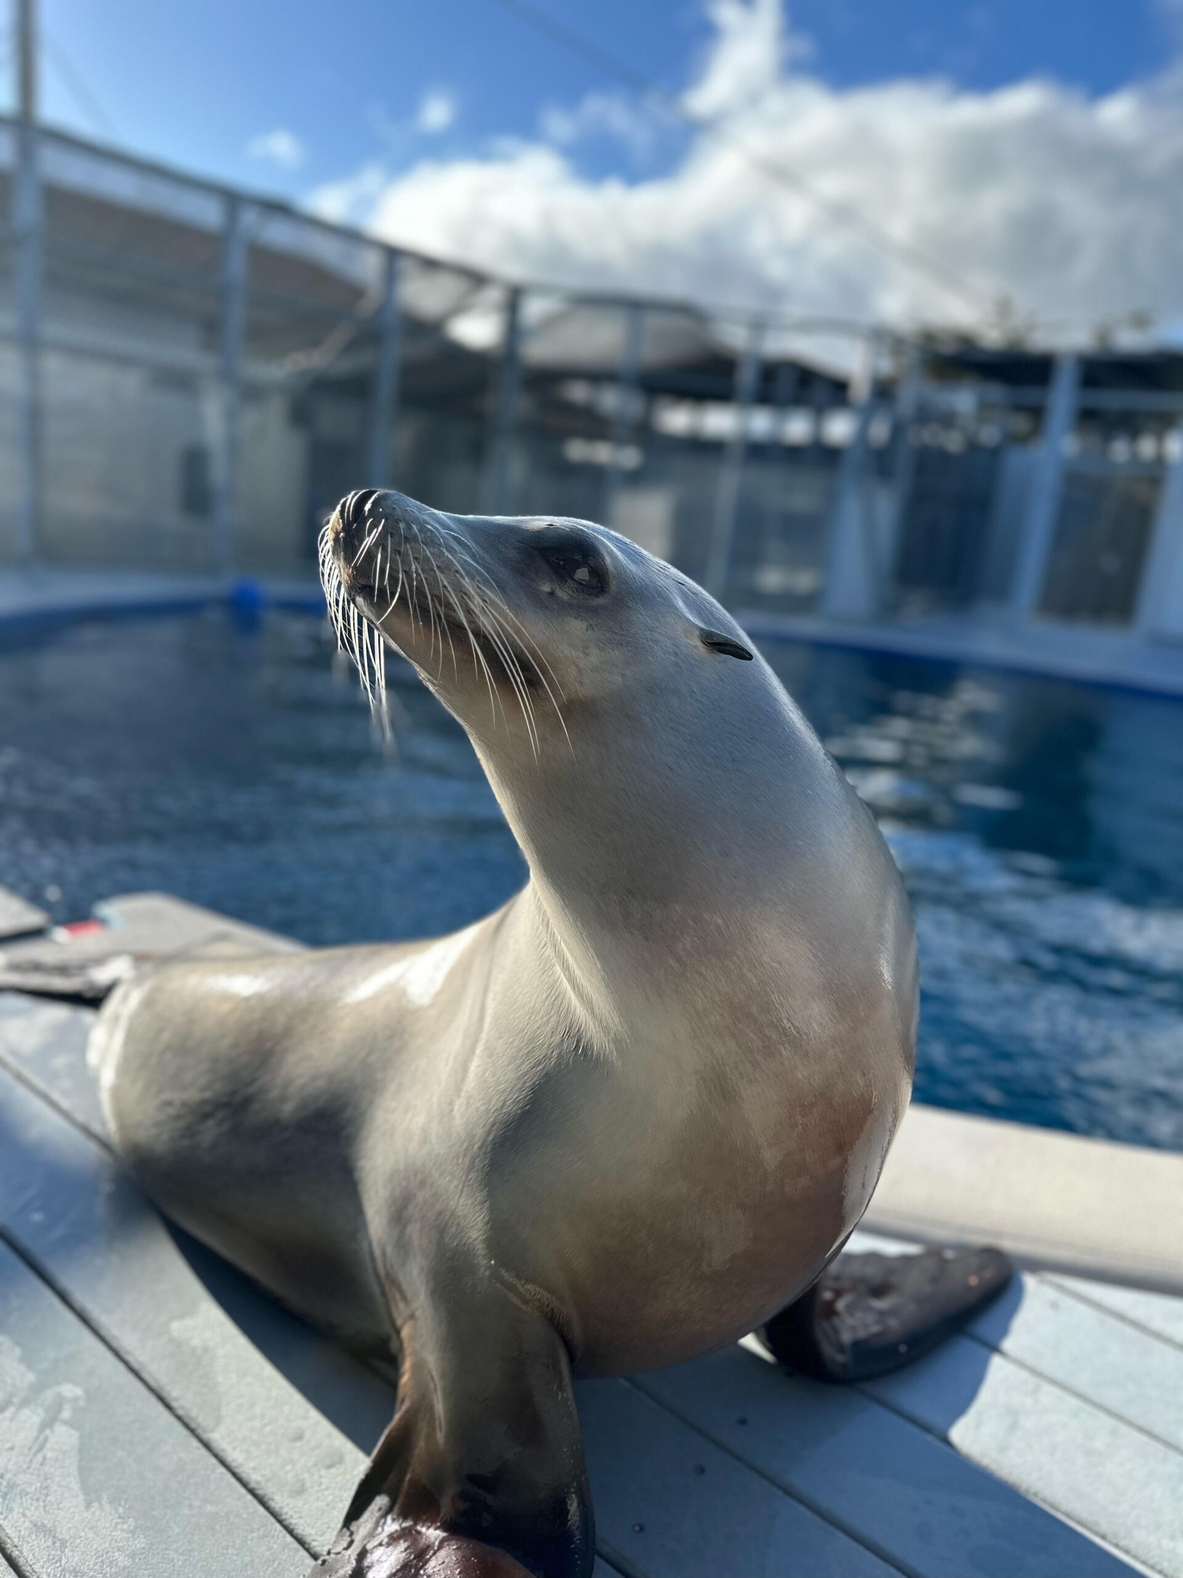
NEUR 411 · NEUROETHOLOGY · FALL 2026
Lecture 91
Sea lions:
brain/neuro anatomy/organization, rhythmic entrainment, auditory–motor coordination, learned commands, and tests of beat synchronization
Date TBD
Jordan Lopez, Ph.D.
Professor of Neurobiology & Biomedical Engineering
Photo: California sea lion Ronan at UC Santa Cruz’s Long Marine Laboratory. Photo by Colleen Reichmuth; NOAA/NMFS 23554.
Notes:
Sea lions: brain/neuro anatomy/organization, rhythmic entrainment, auditory–motor coordination, learned commands, and tests of beat synchronization
Lecture 91. NEUR 411 · NEUROETHOLOGY · FALL 2026. Date TBD.
Image: Photo: California sea lion Ronan at UC Santa Cruz’s Long Marine Laboratory. Photo by Colleen Reichmuth; NOAA/NMFS 23554. Credit: Colleen Reichmuth, UC Santa Cruz; NOAA/NMFS 23554. License: UC Santa Cruz media download: image must be used with supplied caption, including NOAA/NMFS number; no open license stated. Source: https://news.ucsc.edu/2025/05/ronan-sea-lion-beats-humans/

Slide 2
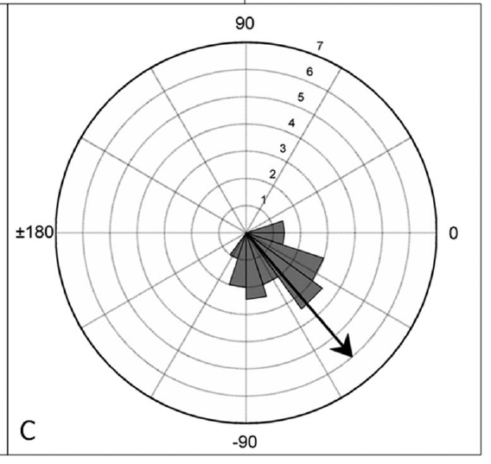
Ronan learns to align movement with sound
Rhythmic entrainment is the adjustment of a repeating movement to an external rhythm. Ronan, a California sea lion, learned to move her head up and down while hearing regularly spaced sounds. The lowest point of each movement supplied a repeatable timing marker.
Cook and colleagues trained this behavior at 80 and 120 beats per minute, then tested other rates and musical recordings. A movement that stays aligned across unfamiliar rates requires flexible timing rather than the repetition of one memorized motor speed.
Ronan lived at the University of California, Santa Cruz. The experimental task underlying her public reputation as a dancing sea lion combined a controlled sound sequence, concealed trainers, video measurements, and food reinforcement for appropriately timed behavior.
Cook et al. (2013), Fig. 1C. Head-bob timing after training at 80 bpm.
Cook et al. (2013)
02
Notes:
• **Rhythmic entrainment** is the adjustment of a repeating movement to an external rhythm. Ronan, a California sea lion, learned to move her head up and down while hearing regularly spaced sounds. The lowest point of each movement supplied a repeatable timing marker.
• Cook and colleagues trained this behavior at 80 and 120 beats per minute, then tested other rates and musical recordings. A movement that stays aligned across unfamiliar rates requires flexible timing rather than the repetition of one memorized motor speed.
• Ronan lived at the University of California, Santa Cruz. The experimental task underlying her public reputation as a dancing sea lion combined a controlled sound sequence, concealed trainers, video measurements, and food reinforcement for appropriately timed behavior.
References:
Cook PF, Rouse A, Wilson M, Reichmuth C (2013). A California sea lion (Zalophus californianus) can keep the beat: Motor entrainment to rhythmic auditory stimuli in a non vocal mimic. Journal of Comparative Psychology 127(4): 412–427. https://doi.org/10.1037/a0032345
Figure: Cook et al. (2013), Fig. 1C. Head-bob timing after training at 80 bpm.
Figure source: https://doi.org/10.1037/a0032345

Slide 3
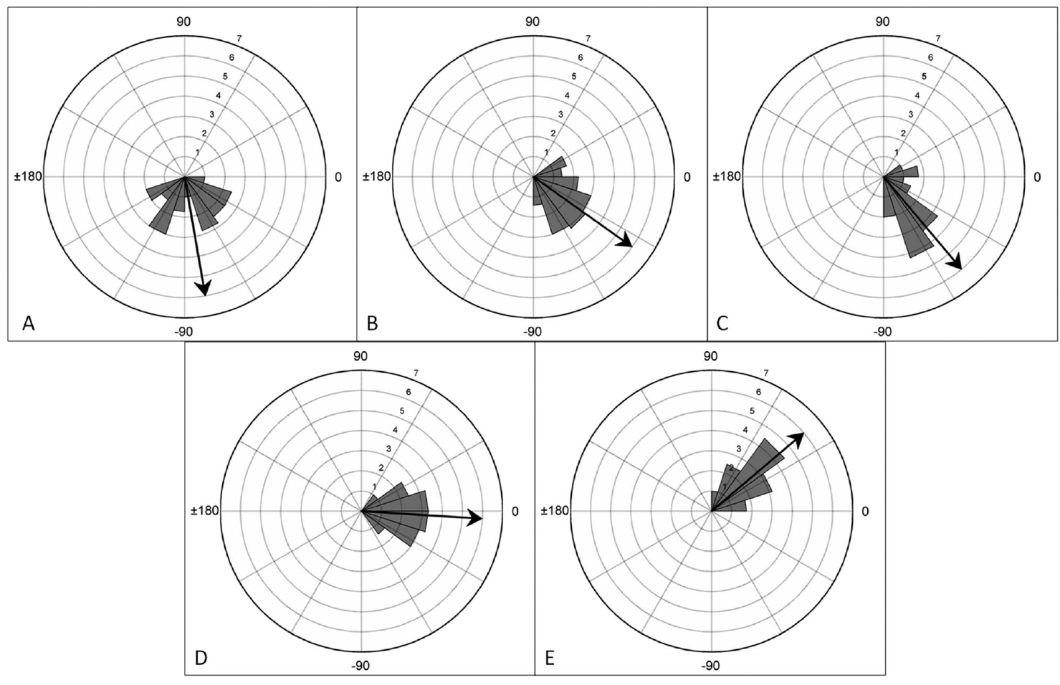
Matching tempo differs from matching the beat
Tempo is the repetition rate of the sound sequence, expressed in beats per minute. Matching tempo means producing the same average number of movements per unit time. Two repeating events can share a tempo while occurring at different points within each cycle.
Phase describes the position of a movement relative to the sound cycle. Synchronization requires a stable timing relationship, ideally with the selected movement landmark near sound onset. The 2013 study measured both the movement rate and its alignment with individual beats.
At different unfamiliar tempos, Ronan maintained organized phase relationships even when her head reached its lowest point before or after the sound. These offsets distinguish successful coordination with the repeating stimulus from exact coincidence at the beat itself.
Cook et al. (2013), Fig. 2. Movement timing at five unfamiliar tempos.
Cook et al. (2013)
03
Notes:
• **Tempo** is the repetition rate of the sound sequence, expressed in beats per minute. Matching tempo means producing the same average number of movements per unit time. Two repeating events can share a tempo while occurring at different points within each cycle.
• **Phase** describes the position of a movement relative to the sound cycle. Synchronization requires a stable timing relationship, ideally with the selected movement landmark near sound onset. The 2013 study measured both the movement rate and its alignment with individual beats.
• At different unfamiliar tempos, Ronan maintained organized phase relationships even when her head reached its lowest point before or after the sound. These offsets distinguish successful coordination with the repeating stimulus from exact coincidence at the beat itself.
References:
Cook PF, Rouse A, Wilson M, Reichmuth C (2013). A California sea lion (Zalophus californianus) can keep the beat: Motor entrainment to rhythmic auditory stimuli in a non vocal mimic. Journal of Comparative Psychology 127(4): 412–427. https://doi.org/10.1037/a0032345
Figure: Cook et al. (2013), Fig. 2. Movement timing at five unfamiliar tempos.
Figure source: https://doi.org/10.1037/a0032345

Slide 4
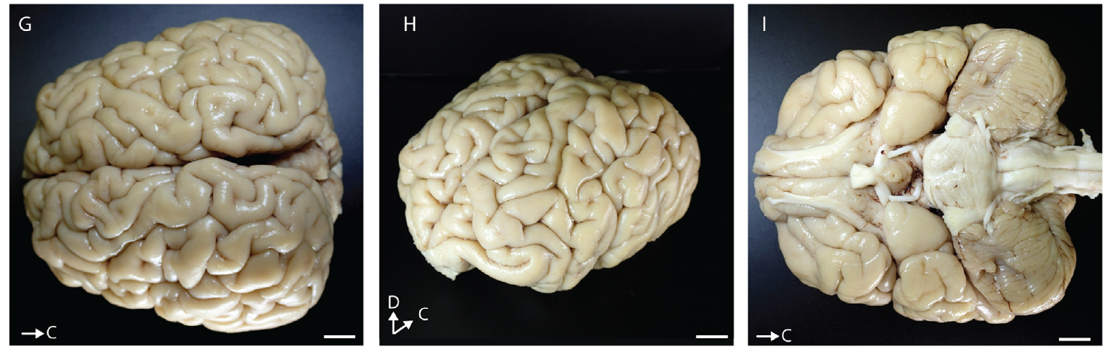
A folded cortex overlies a large cerebellum
Neuroanatomy is the organization of the nervous system and its structures. Cerebral cortex is the outer sheet of the cerebrum. Sawyer and colleagues examined a juvenile California sea-lion brain whose cortical surface contained numerous folds. Gyri are the raised folds; sulci are the grooves separating them. The two hemispheres had similar but nonidentical groove patterns.
The fixed specimen was 10.2 cm long and 10.1 cm wide near its posterior end, compared with 6.0 cm across the anterior portion. These are dimensions of the preserved juvenile specimen, rather than measurements of Ronan or a standard adult brain.
A large cerebellum, a brain structure involved in movement coordination, lay beneath the posterior cerebral region. The study localized sensory cortex using tissue stains and anatomical landmarks. Folding alone did not locate functional regions; microscopic organization supplied the boundaries of the somatosensory area.
Sawyer et al. (2016), Fig. 7G–I. Dorsal, isometric, and ventral views of a juvenile sea-lion brain.
Sawyer et al. (2016)
04
Notes:
• **Neuroanatomy** is the organization of the nervous system and its structures. **Cerebral cortex** is the outer sheet of the cerebrum. Sawyer and colleagues examined a juvenile California sea-lion brain whose cortical surface contained numerous folds. **Gyri** are the raised folds; **sulci** are the grooves separating them. The two hemispheres had similar but nonidentical groove patterns.
• The fixed specimen was 10.2 cm long and 10.1 cm wide near its posterior end, compared with 6.0 cm across the anterior portion. These are dimensions of the preserved juvenile specimen, rather than measurements of Ronan or a standard adult brain.
• A large **cerebellum**, a brain structure involved in movement coordination, lay beneath the posterior cerebral region. The study localized sensory cortex using tissue stains and anatomical landmarks. Folding alone did not locate functional regions; microscopic organization supplied the boundaries of the somatosensory area.
• The examined juvenile brain weighed 288.4 g after perfusion and immersion fixation. Preservation and developmental stage matter when comparing its dimensions with living adult animals.
References:
Sawyer EK, Turner EC, Kaas JH (2016). Somatosensory brainstem, thalamus, and cortex of the California sea lion (Zalophus californianus). Journal of Comparative Neurology 524(9):1957–1975. https://doi.org/10.1002/cne.23984
Figure: Sawyer et al. (2016), Fig. 7G–I. Dorsal, isometric, and ventral views of a juvenile sea-lion brain.
Figure source: https://doi.org/10.1002/cne.23984

Slide 5
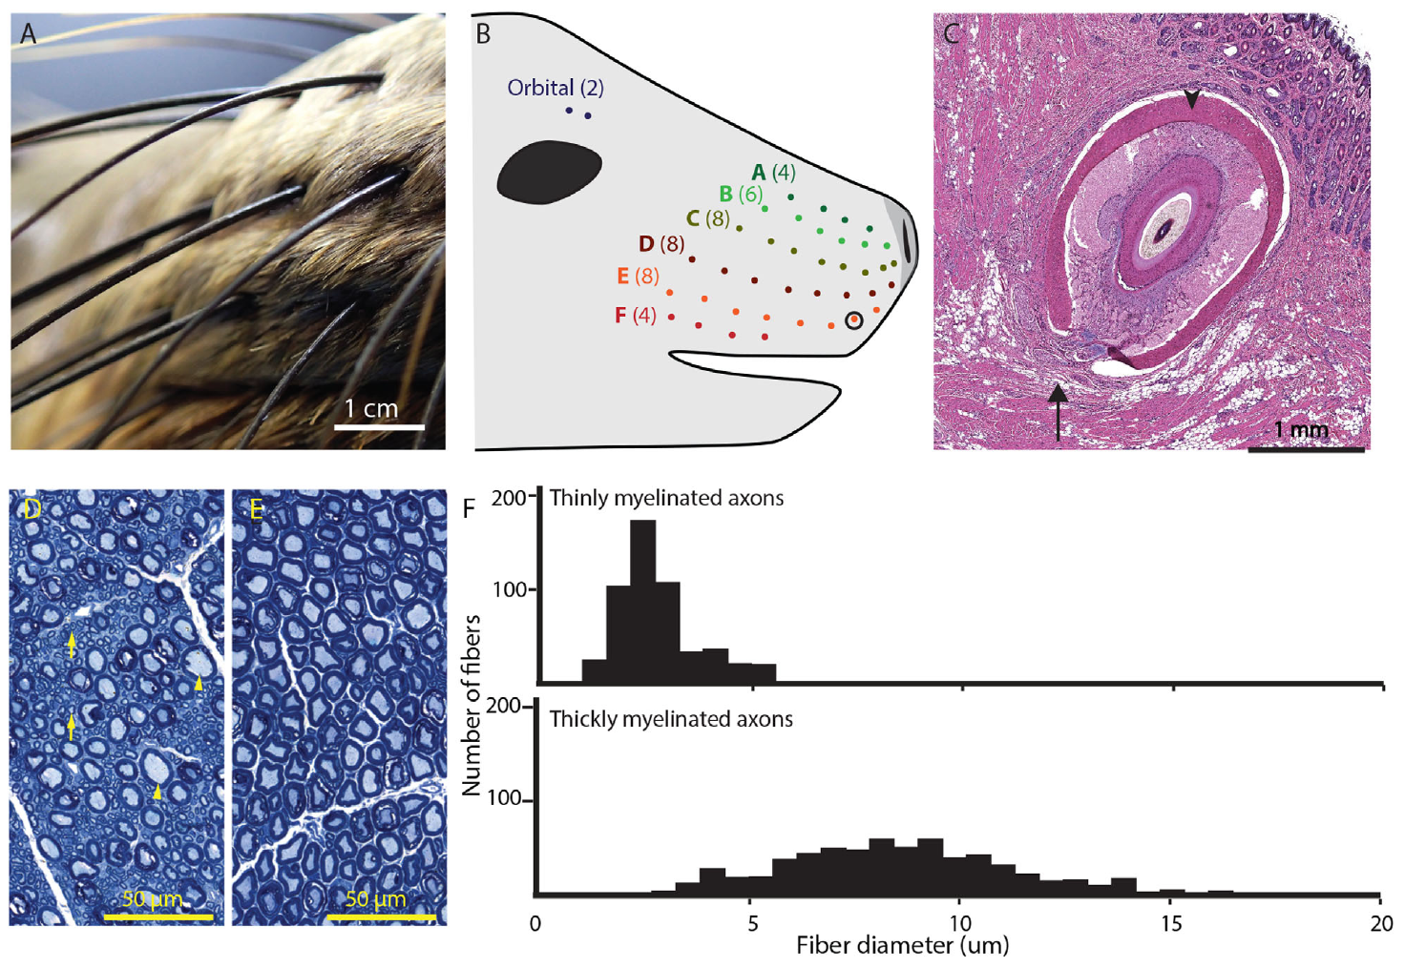
Whisker follicles connect touch to the trigeminal nerve
Vibrissae are specialized whiskers whose follicles receive sensory innervation. The examined sea lions had 38 whiskers arranged in six rows on each cheek pad. Their facial array provides many separate points at which contact or water movement can deform a whisker.
A stained follicle contained a blood-filled cavernous sinus and a deep vibrissal nerve entering its base. This structure differs from an ordinary coat-hair follicle. Whisker deformation is therefore delivered to an innervated sensory organ embedded in the skin rather than detected by the hair shaft itself.
The trigeminal nerve carries facial somatosensory signals, meaning information about touch and related bodily sensation. Its thick sensory root lay beside a separate, smaller motor root. Axons are nerve-cell fibers that conduct signals; myelin is their insulating sheath. Microscopy identified thinly and thickly myelinated axons in the pathway carrying facial information into the brainstem.
Sawyer et al. (2016), Fig. 2A–F. Whiskers, an innervated follicle, and sensory and motor roots.
Sawyer et al. (2016)
05
Notes:
• **Vibrissae** are specialized whiskers whose follicles receive sensory innervation. The examined sea lions had 38 whiskers arranged in six rows on each cheek pad. Their facial array provides many separate points at which contact or water movement can deform a whisker.
• A stained follicle contained a blood-filled cavernous sinus and a deep vibrissal nerve entering its base. This structure differs from an ordinary coat-hair follicle. Whisker deformation is therefore delivered to an innervated sensory organ embedded in the skin rather than detected by the hair shaft itself.
• The **trigeminal nerve** carries facial somatosensory signals, meaning information about touch and related bodily sensation. Its thick sensory root lay beside a separate, smaller motor root. **Axons** are nerve-cell fibers that conduct signals; **myelin** is their insulating sheath. Microscopy identified thinly and thickly myelinated axons in the pathway carrying facial information into the brainstem.
References:
Sawyer EK, Turner EC, Kaas JH (2016). Somatosensory brainstem, thalamus, and cortex of the California sea lion (Zalophus californianus). Journal of Comparative Neurology 524(9):1957–1975. https://doi.org/10.1002/cne.23984
Figure: Sawyer et al. (2016), Fig. 2A–F. Whiskers, an innervated follicle, and sensory and motor roots.
Figure source: https://doi.org/10.1002/cne.23984

Slide 6
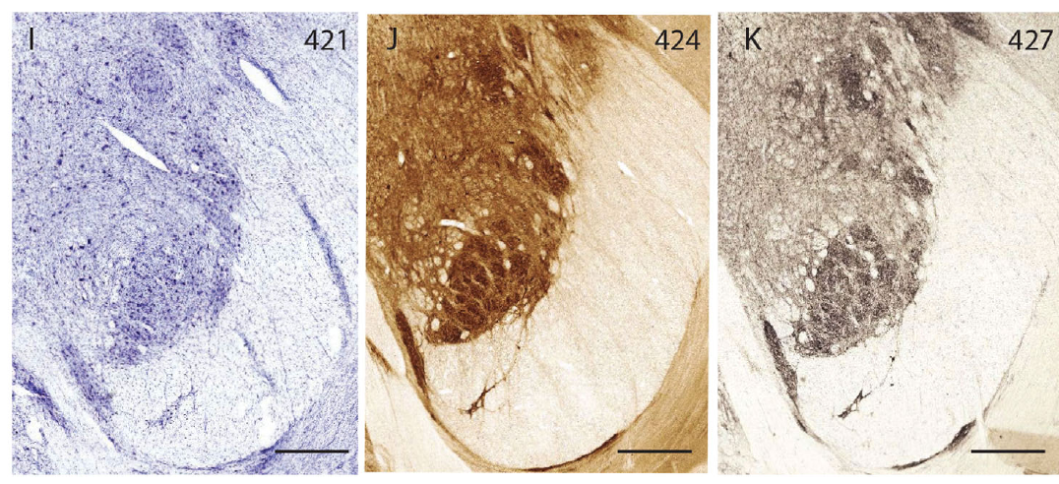
Brainstem modules organize facial sensory input
The principal sensory trigeminal nucleus is a brainstem relay for facial somatosensory information. In sea-lion tissue, this nucleus contained clusters separated by relatively cell-sparse partitions. Related modules also occurred in the spinal trigeminal nuclei, which extend the facial representation through the brainstem.
Nissl staining reveals neuronal cell bodies. Cytochrome oxidase staining marks metabolic organization, while vesicular glutamate transporter 1 staining identified dense afferent terminal regions. Glutamate is a neurotransmitter, a chemical signal released at synapses. This transporter packages it in presynaptic vesicles. The three preparations converged on a modular architecture instead of a uniform mass of tissue.
The arrangement resembled the facial whisker array, especially the six-row organization in the interpolaris subdivision. Individual sections did not yield an exact whisker-to-module assignment. The anatomical finding is a partitioned facial sensory representation, with dense incoming terminals concentrated within its modules.
Sawyer et al. (2016), Fig. 4I–K. Principal sensory nucleus stained for cells, metabolism, and VGLUT1.
Sawyer et al. (2016)
06
Notes:
• The **principal sensory trigeminal nucleus** is a brainstem relay for facial somatosensory information. In sea-lion tissue, this nucleus contained clusters separated by relatively cell-sparse partitions. Related modules also occurred in the spinal trigeminal nuclei, which extend the facial representation through the brainstem.
• **Nissl staining** reveals neuronal cell bodies. **Cytochrome oxidase staining** marks metabolic organization, while vesicular glutamate transporter 1 staining identified dense afferent terminal regions. **Glutamate** is a neurotransmitter, a chemical signal released at synapses. This transporter packages it in presynaptic vesicles. The three preparations converged on a modular architecture instead of a uniform mass of tissue.
• The arrangement resembled the facial whisker array, especially the six-row organization in the interpolaris subdivision. Individual sections did not yield an exact whisker-to-module assignment. The anatomical finding is a partitioned facial sensory representation, with dense incoming terminals concentrated within its modules.
• Vesicular glutamate transporters package glutamate in presynaptic vesicles. VGLUT1 staining marks the organization of glutamatergic input terminals; staining is an anatomical assay, not a recording of sensory firing during behavior.
References:
Sawyer EK, Turner EC, Kaas JH (2016). Somatosensory brainstem, thalamus, and cortex of the California sea lion (Zalophus californianus). Journal of Comparative Neurology 524(9):1957–1975. https://doi.org/10.1002/cne.23984
Figure: Sawyer et al. (2016), Fig. 4I–K. Principal sensory nucleus stained for cells, metabolism, and VGLUT1.
Figure source: https://doi.org/10.1002/cne.23984

Slide 7
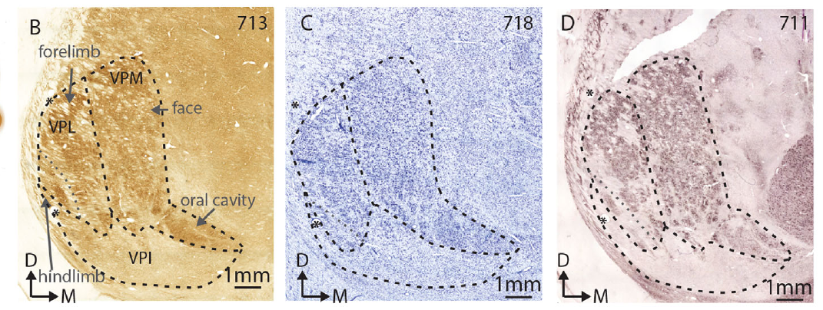
The thalamus separates face and body representations
The thalamus contains relays between ascending sensory pathways and cerebral cortex. The sea-lion ventral posterior nucleus was distinguished from surrounding tissue by large neuronal cell bodies and dense staining for cytochrome oxidase and vesicular glutamate transporter 2.
Its ventroposterior medial subdivision, or VPM, occupied a large part of the nucleus and corresponds to facial representation in the mammalian somatosensory pathway. The neighboring ventroposterior lateral subdivision, or VPL, corresponds to bodily representation. Their boundaries changed across successive sections rather than forming identical shapes at every depth.
Lightly stained partitions divided the nucleus internally. The sea-lion preparation established these subdivisions anatomically, without a physiological point-by-point body map. Facial sensation thus has an extensive thalamic territory between its brainstem representation and the cortical sensory region.
Sawyer et al. (2016), Fig. 6B–D. Matched sections identify the somatosensory thalamic subdivisions.
Sawyer et al. (2016)
07
Notes:
• The **thalamus** contains relays between ascending sensory pathways and cerebral cortex. The sea-lion **ventral posterior nucleus** was distinguished from surrounding tissue by large neuronal cell bodies and dense staining for cytochrome oxidase and vesicular glutamate transporter 2.
• Its **ventroposterior medial subdivision**, or VPM, occupied a large part of the nucleus and corresponds to facial representation in the mammalian somatosensory pathway. The neighboring **ventroposterior lateral subdivision**, or VPL, corresponds to bodily representation. Their boundaries changed across successive sections rather than forming identical shapes at every depth.
• Lightly stained partitions divided the nucleus internally. The sea-lion preparation established these subdivisions anatomically, without a physiological point-by-point body map. Facial sensation thus has an extensive thalamic territory between its brainstem representation and the cortical sensory region.
References:
Sawyer EK, Turner EC, Kaas JH (2016). Somatosensory brainstem, thalamus, and cortex of the California sea lion (Zalophus californianus). Journal of Comparative Neurology 524(9):1957–1975. https://doi.org/10.1002/cne.23984
Figure: Sawyer et al. (2016), Fig. 6B–D. Matched sections identify the somatosensory thalamic subdivisions.
Figure source: https://doi.org/10.1002/cne.23984

Slide 8
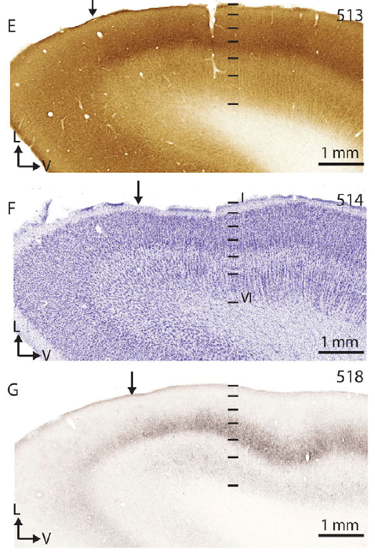
Sensory cortical layer 4 receives dense input
Primary somatosensory cortex, or S1, is a cerebral region receiving bodily sensory information. Sawyer and colleagues localized a presumptive S1 region just anterior to the major vertical fissure using its microscopic organization and position within the folded sea-lion cortex.
Cortical layers are bands that differ in neuronal populations and connections. In this region, layer 4 contained densely packed cells and stained strongly for cytochrome oxidase and vesicular glutamate transporter 2. Layer 5 was relatively cell-sparse, whereas layer 6 was thick and cell-dense.
The VGLUT2-rich layer identifies a concentration of glutamatergic input terminals associated with primary sensory cortex. Tissue organization therefore connected a macroscopically folded surface with a specific sensory territory. Reconstructing successive stained sections placed that territory relative to the coronal and suprasylvian sulci.
Sawyer et al. (2016), Fig. 8E–G. Layer-specific metabolic, neuronal, and VGLUT2 staining.
Sawyer et al. (2016)
08
Notes:
• **Primary somatosensory cortex**, or S1, is a cerebral region receiving bodily sensory information. Sawyer and colleagues localized a presumptive S1 region just anterior to the major vertical fissure using its microscopic organization and position within the folded sea-lion cortex.
• **Cortical layers** are bands that differ in neuronal populations and connections. In this region, layer 4 contained densely packed cells and stained strongly for cytochrome oxidase and vesicular glutamate transporter 2. Layer 5 was relatively cell-sparse, whereas layer 6 was thick and cell-dense.
• The VGLUT2-rich layer identifies a concentration of glutamatergic input terminals associated with primary sensory cortex. Tissue organization therefore connected a macroscopically folded surface with a specific sensory territory. Reconstructing successive stained sections placed that territory relative to the coronal and suprasylvian sulci.
References:
Sawyer EK, Turner EC, Kaas JH (2016). Somatosensory brainstem, thalamus, and cortex of the California sea lion (Zalophus californianus). Journal of Comparative Neurology 524(9):1957–1975. https://doi.org/10.1002/cne.23984
Figure: Sawyer et al. (2016), Fig. 8E–G. Layer-specific metabolic, neuronal, and VGLUT2 staining.
Figure source: https://doi.org/10.1002/cne.23984

Slide 9
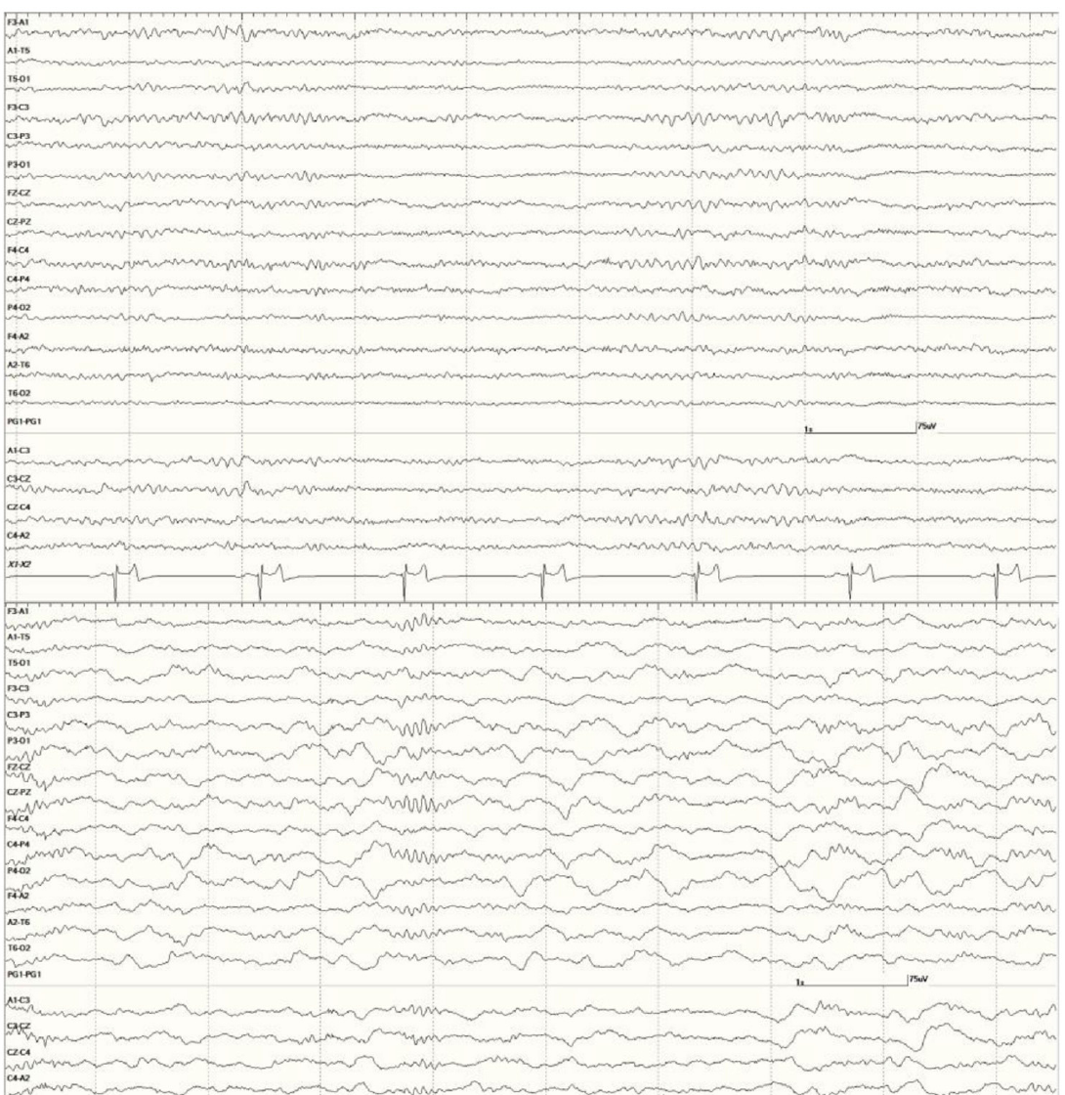
Brain rhythms change with arousal state
Electroencephalography, or EEG, records voltage fluctuations through electrodes near the head. Williams and colleagues adapted the electrode arrangement to California sea lions and identified patterns in neurologically normal animals alongside recordings from animals with neurological disease.
Wakeful recordings included low-amplitude beta activity, faster than 13 Hz, interspersed with alpha activity at 8–13 Hz. Slow-wave sleep contained high-amplitude delta activity, slower than 4 Hz, and sleep spindles around 12–14 Hz. The same nervous system can therefore produce different temporal activity patterns across states.
These EEG rhythms are electrical activity patterns, whereas Ronan’s entrainment is a measured relationship between movement and an external sound sequence. The distinction separates physiological frequency from behavioral beat keeping. Sedation and arousal were tracked because they altered the EEG state being interpreted.
Williams et al. (2023), Fig. 2A–B. Sea-lion EEG during wakefulness and slow-wave sleep.
Williams et al. (2023)
09
Notes:
• **Electroencephalography**, or EEG, records voltage fluctuations through electrodes near the head. Williams and colleagues adapted the electrode arrangement to California sea lions and identified patterns in neurologically normal animals alongside recordings from animals with neurological disease.
• Wakeful recordings included low-amplitude **beta activity**, faster than 13 Hz, interspersed with **alpha activity** at 8–13 Hz. Slow-wave sleep contained high-amplitude **delta activity**, slower than 4 Hz, and sleep spindles around 12–14 Hz. The same nervous system can therefore produce different temporal activity patterns across states.
• These EEG rhythms are electrical activity patterns, whereas Ronan’s entrainment is a measured relationship between movement and an external sound sequence. The distinction separates physiological frequency from behavioral beat keeping. Sedation and arousal were tracked because they altered the EEG state being interpreted.
• Many animals received sedatives during electrode placement. These clinical recordings were not an auditory synchronization experiment or a natural-sleep survey. The comparison uses the paper’s neurologically normal wakeful and slow-wave examples.
References:
Williams DC, Haulena M, Dennison S, Waugh L, Goldstein T, Nutter F, Van Bonn B, Hoard V, Laxer KD, Buckmaster PS, Gulland FMD, Tharp B (2023). Pinniped electroencephalography: Methodology and findings in California sea lions (Zalophus californianus). Frontiers in Veterinary Science 10:1040125. https://doi.org/10.3389/fvets.2023.1040125
Figure: Williams et al. (2023), Fig. 2A–B. Sea-lion EEG during wakefulness and slow-wave sleep.
Figure source: https://doi.org/10.3389/fvets.2023.1040125

Slide 10
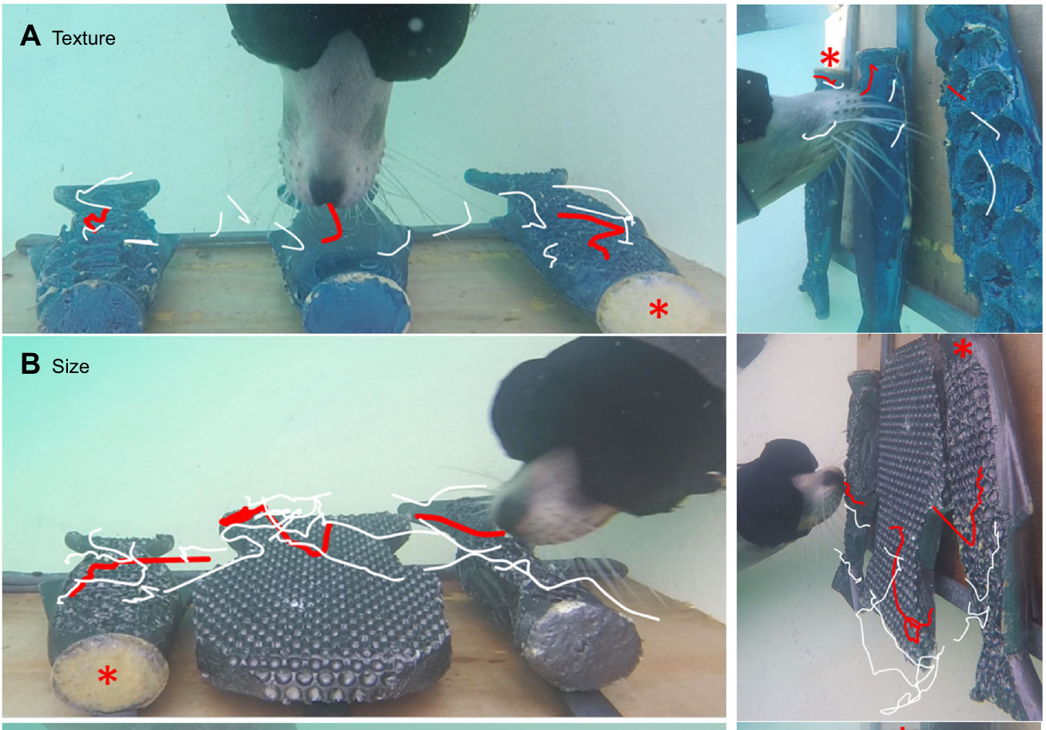
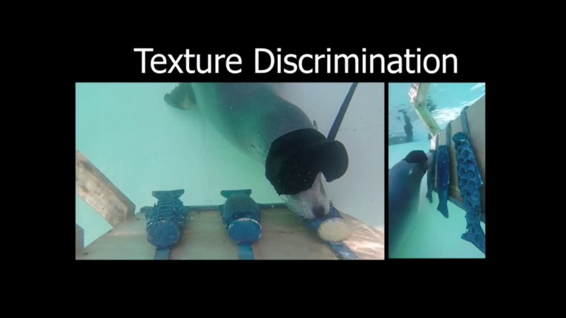
Touch exploration changes with the sensory task
Active sensing means moving a sensory organ to acquire information relevant to a task. Lo, a California sea lion, used different head and whisker movements when discriminating texture, size, or visual brightness. Blindfolds restricted the texture and size tasks to tactile exploration.
For texture, Lo swept laterally across the surfaces. For size, she moved toward the object edges and made larger whisker movements. Average whisker excursions were about 34° for texture and 47° for size, compared with 24° during visual brightness discrimination.
The target remained the intermediate stimulus among two distractors. A visual control reduced the need to explore by touch, and head and whisker movements declined. Task-specific movement therefore changed how the sensory surface was sampled, linking perceptual demands to the motor strategy used to solve them.
Milne et al. (2021), Fig. 1A–B. Lo explores texture and size with different whisker trajectories.
Milne et al. (2021), Movie 1. Lo explores texture, size, and visual brightness.
Milne et al. (2021)
10
Notes:
• **Active sensing** means moving a sensory organ to acquire information relevant to a task. Lo, a California sea lion, used different head and whisker movements when discriminating texture, size, or visual brightness. Blindfolds restricted the texture and size tasks to tactile exploration.
• For texture, Lo swept laterally across the surfaces. For size, she moved toward the object edges and made larger whisker movements. Average whisker excursions were about 34° for texture and 47° for size, compared with 24° during visual brightness discrimination.
• The target remained the intermediate stimulus among two distractors. A visual control reduced the need to explore by touch, and head and whisker movements declined. Task-specific movement therefore changed how the sensory surface was sampled, linking perceptual demands to the motor strategy used to solve them.
• Movie 1 contains the original texture, size, and brightness trials in a single recording. Its segments are not counted as separate movies.
References:
Milne AO, Orton L, Black CH, Jones GC, Sullivan M, Grant RA (2021). California sea lions employ task-specific strategies for active touch sensing. Journal of Experimental Biology 224(21):jeb243085. https://doi.org/10.1242/jeb.243085
Figure: Milne et al. (2021), Fig. 1A–B. Lo explores texture and size with different whisker trajectories.
Figure source: https://doi.org/10.1242/jeb.243085
Embedded recording: Milne et al. (2021), Movie 1. Lo explores texture, size, and visual brightness.
Source URL: https://static-movie-usa.glencoesoftware.com/source/10.1242/861/cf6333a8eda59f3724280a480f4c6d468185fa4d/JEB243085.MovieS1.mp4
Article DOI: https://doi.org/10.1242/jeb.243085
Credit: Milne, Orton, Black, Jones, Sullivan, and Grant. License: CC BY 4.0.
Discuss the displayed behavior and compare it with the adjacent published measurements. Original timing and audio retained; poster is an unedited frame. The embedded MP4 preserves native display proportions, original timing, scene order, and audio; compatibility conversion details are recorded in media_conversion_audit.json when applicable. Desktop PowerPoint playback and Google Slides import were not tested.

Slide 11
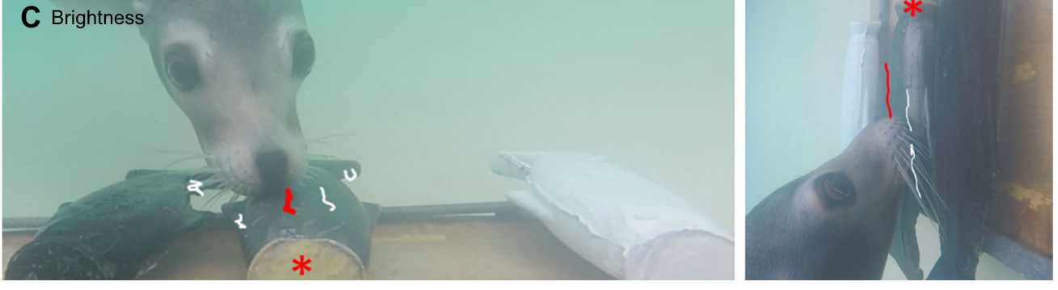
A learned command initiates sensory-guided choice
A learned command is a cue associated with a trained action or task. In Lo’s discrimination experiment, the trainer used “find it” to initiate exploration after the stimuli had been placed underwater. The command started a task whose solution still depended on information from the objects.
Lo indicated her choice by resting her nose on the selected stimulus for more than 3 s and retracting her whiskers. Correct choices produced a whistle followed by fish. The whistle served as a conditioned reinforcer, a previously learned signal marking success before the primary food reward arrived.
Stimulus positions changed between trials, so the same command could not be solved by approaching one permanent location. After learning, decisions during exploration took less than 1 s and accuracy approached complete target identification. The command controlled task initiation, while sensory discrimination controlled which object was selected.
Milne et al. (2021), Fig. 1C. Lo selects a brightness target with reduced tactile exploration.
Milne et al. (2021)
11
Notes:
• A **learned command** is a cue associated with a trained action or task. In Lo’s discrimination experiment, the trainer used “find it” to initiate exploration after the stimuli had been placed underwater. The command started a task whose solution still depended on information from the objects.
• Lo indicated her choice by resting her nose on the selected stimulus for more than 3 s and retracting her whiskers. Correct choices produced a whistle followed by fish. The whistle served as a **conditioned reinforcer**, a previously learned signal marking success before the primary food reward arrived.
• Stimulus positions changed between trials, so the same command could not be solved by approaching one permanent location. After learning, decisions during exploration took less than 1 s and accuracy approached complete target identification. The command controlled task initiation, while sensory discrimination controlled which object was selected.
References:
Milne AO, Orton L, Black CH, Jones GC, Sullivan M, Grant RA (2021). California sea lions employ task-specific strategies for active touch sensing. Journal of Experimental Biology 224(21):jeb243085. https://doi.org/10.1242/jeb.243085
Figure: Milne et al. (2021), Fig. 1C. Lo selects a brightness target with reduced tactile exploration.
Figure source: https://doi.org/10.1242/jeb.243085

Slide 12
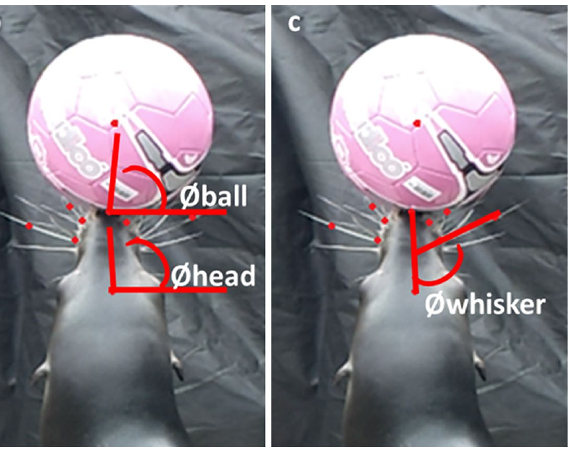
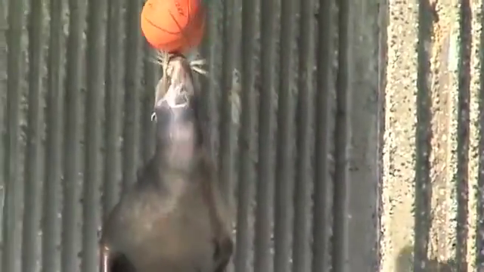
Whisker adjustments precede head corrections
Ball balancing requires continuous adjustments as the supported object changes orientation. Milne and Grant recorded California sea lions named Gina, Anya, and Elmo performing this familiar trained action. The animals received ball-balancing commands and maintained the action until a trainer marked completion.
Whisker asymmetry describes the difference between average whisker angles on the two sides of the face. Changes in this measure followed ball orientation more closely and sooner than changes in head orientation. The reported average delays were approximately 27 ms for whiskers and 129 ms for the head.
Balancing therefore recruits control of the sensory array as well as movement of the larger support surface. Whisker movements need not merely follow the head passively. The supplied recording preserves the brief analyzed interval at its original speed, in which ball position and whisker configuration change together.
Milne and Grant (2014), Fig. 1b–c. Ball, head, and whisker positions during balancing.
Blackpool Zoo (2009). Bimbo balances a ball on land and in water; observational demonstration.
Milne and Grant (2014)
12
Notes:
• Ball balancing requires continuous adjustments as the supported object changes orientation. Milne and Grant recorded California sea lions named Gina, Anya, and Elmo performing this familiar trained action. The animals received ball-balancing commands and maintained the action until a trainer marked completion.
• **Whisker asymmetry** describes the difference between average whisker angles on the two sides of the face. Changes in this measure followed ball orientation more closely and sooner than changes in head orientation. The reported average delays were approximately 27 ms for whiskers and 129 ms for the head.
• Balancing therefore recruits control of the sensory array as well as movement of the larger support surface. Whisker movements need not merely follow the head passively. The supplied recording preserves the brief analyzed interval at its original speed, in which ball position and whisker configuration change together.
• The source movie lasts 0.74 s. It is the original high-frame-rate analysis interval, not a long demonstration or a movie slowed for presentation. Use full-screen playback and replay if needed without changing its timing.
References:
Milne AO, Grant RA (2014). Characterisation of whisker control in the California sea lion (Zalophus californianus) during a complex, dynamic sensorimotor task. Journal of Comparative Physiology A 200:871–879. https://doi.org/10.1007/s00359-014-0931-1
Figure: Milne and Grant (2014), Fig. 1b–c. Ball, head, and whisker positions during balancing.
Figure source: https://doi.org/10.1007/s00359-014-0931-1
Embedded recording: Blackpool Zoo (2009). Bimbo balances a ball on land and in water; observational demonstration.
Source URL: https://www.youtube.com/watch?v=aoYOyxJu9EM
Source: observational zoo recording; no article DOI
Credit: Blackpool Zoo. License: No open license stated; instructor-provided recording.
Discuss the displayed behavior and compare it with the adjacent published measurements. Original timing and audio retained; poster is an unedited frame. The embedded MP4 preserves native display proportions, original timing, scene order, and audio; compatibility conversion details are recorded in media_conversion_audit.json when applicable. Desktop PowerPoint playback and Google Slides import were not tested.
Instructor-authorized excerpt: 6 to 50 seconds. H264 CRF26; AAC96kbps; no speed change; original frame rate and audio timing retained. Spatial crop: None. This excerpt retains the source behavior and sound sequence; omitted sections are outside the selected task.
Bimbo is a zoo demonstration, not a participant in the adjacent Milne and Grant measurements.

Slide 13
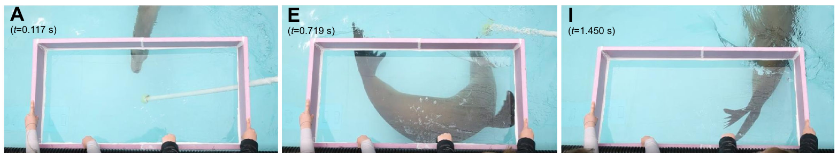
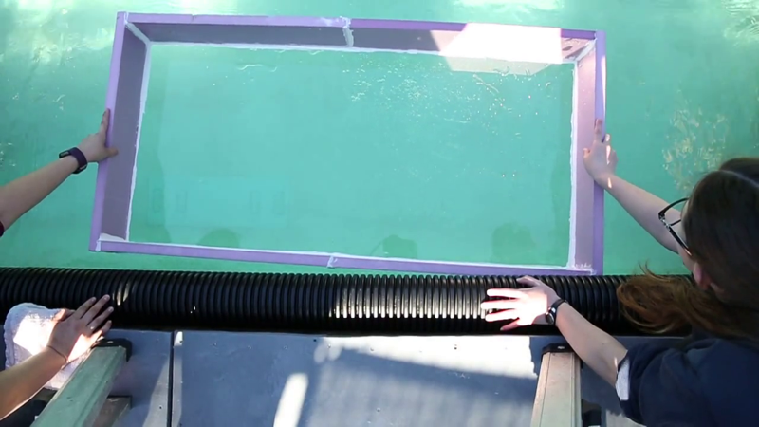
Banking turns recruit the hindflippers
Sea lions propel ordinary forward swimming with their foreflippers, while the hindflippers can trail behind. A banking turn combines rolling the body with changing the swimming direction. Leahy and colleagues trained sea lions to complete 180° turns beneath an underwater viewing window.
At turn onset, the animal abducted its foreflippers, moving them away from the body, and rolled approximately 90°. The hindflippers spread and rotated, expanding their surface area. Their position behind the body’s center of gravity allows a hydrodynamic force to influence body orientation as well as the path of travel.
The hindflippers’ average angle of attack, their orientation relative to the approaching flow, was about 28° during turning. They remained spread during the maneuver and were adducted, brought together, as forward swimming resumed. Coordinated control therefore changes the role of an appendage with the behavioral requirement.
Leahy et al. (2021), Fig. 3A, E, I. Successive stages of a sea-lion banking turn.
Leahy et al. (2021), Movie 3. A trained sea lion executes a 180° left banking turn.
Leahy et al. (2021)
13
Notes:
• Sea lions propel ordinary forward swimming with their foreflippers, while the hindflippers can trail behind. A **banking turn** combines rolling the body with changing the swimming direction. Leahy and colleagues trained sea lions to complete 180° turns beneath an underwater viewing window.
• At turn onset, the animal abducted its foreflippers, moving them away from the body, and rolled approximately 90°. The hindflippers spread and rotated, expanding their surface area. Their position behind the body’s center of gravity allows a hydrodynamic force to influence body orientation as well as the path of travel.
• The hindflippers’ average **angle of attack**, their orientation relative to the approaching flow, was about 28° during turning. They remained spread during the maneuver and were adducted, brought together, as forward swimming resumed. Coordinated control therefore changes the role of an appendage with the behavioral requirement.
• Movie 3 records a trained adult female making a left banking turn. This is coordinated locomotion, not evidence that she follows an auditory musical beat.
References:
Leahy AM, Fish FE, Kerr SJ, Zeligs JA, Skrovan S, Cardenas KL, Leftwich MC (2021). The role of California sea lion (Zalophus californianus) hindflippers as aquatic control surfaces for maneuverability. Journal of Experimental Biology 224(20):jeb243020. https://doi.org/10.1242/jeb.243020
Figure: Leahy et al. (2021), Fig. 3A, E, I. Successive stages of a sea-lion banking turn.
Figure source: https://doi.org/10.1242/jeb.243020
Embedded recording: Leahy et al. (2021), Movie 3. A trained sea lion executes a 180° left banking turn.
Source URL: https://static-movie-usa.glencoesoftware.com/source/10.1242/738/918c6b425b28fbbb9ac7bd4aafad3298129ba4a7/JEB243020.MovieS3.mp4
Article DOI: https://doi.org/10.1242/jeb.243020
Credit: Leahy, Fish, Kerr, Zeligs, Skrovan, Cardenas, and Leftwich. License: Copyright The Company of Biologists; no open license stated.
Discuss the displayed behavior and compare it with the adjacent published measurements. Original timing and audio retained; poster is an unedited frame. The embedded MP4 preserves native display proportions, original timing, scene order, and audio; compatibility conversion details are recorded in media_conversion_audit.json when applicable. Desktop PowerPoint playback and Google Slides import were not tested.

Slide 14
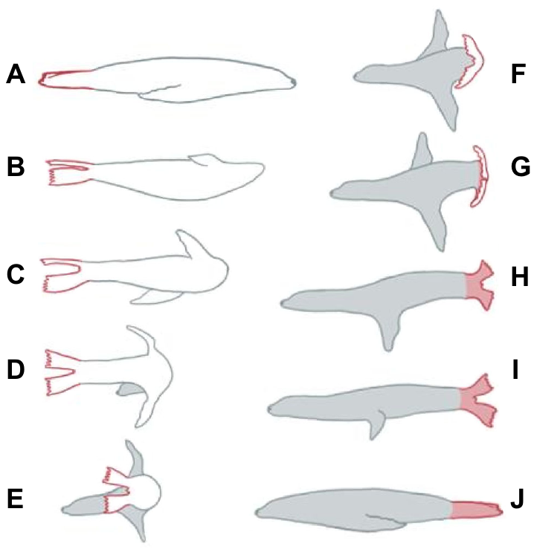
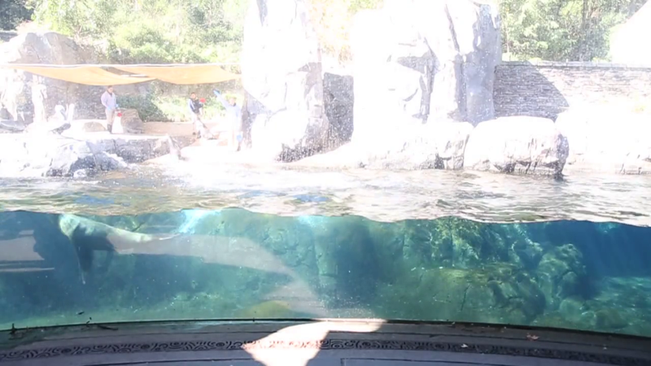
Leaping alternates propulsion and body stabilization
Porpoising is a swimming pattern that repeatedly carries the body above and below the water surface. A trained California sea lion performed consecutive leaps while cameras recorded aerial and submerged phases. The full cycle lasted about 1.5 s in the analyzed captive performance.
The foreflippers generated propulsive strokes during submerged swimming. The hindflippers spread beneath the water and helped stabilize the posterior body region. At the fully aerial crest, the flippers were held against the body or folded rather than continuously generating force against water.
Water entry began with the nose along a curved path, followed by repositioning the foreflippers and hindflippers for the submerged phase. Hindflipper angle of attack during the analyzed submerged phase averaged about 15°. The coordinated cycle thus changes the timing and orientation of several body parts as the surrounding medium changes.
Leahy et al. (2021), Fig. 1. Sea-lion hindflipper geometry and spread configuration.
Leahy et al. (2021), Movie 1. A captive sea lion completes a porpoising bout.
Leahy et al. (2021)
14
Notes:
• **Porpoising** is a swimming pattern that repeatedly carries the body above and below the water surface. A trained California sea lion performed consecutive leaps while cameras recorded aerial and submerged phases. The full cycle lasted about 1.5 s in the analyzed captive performance.
• The foreflippers generated propulsive strokes during submerged swimming. The hindflippers spread beneath the water and helped stabilize the posterior body region. At the fully aerial crest, the flippers were held against the body or folded rather than continuously generating force against water.
• Water entry began with the nose along a curved path, followed by repositioning the foreflippers and hindflippers for the submerged phase. Hindflipper angle of attack during the analyzed submerged phase averaged about 15°. The coordinated cycle thus changes the timing and orientation of several body parts as the surrounding medium changes.
• Movie 1 records the captive porpoising bout. The paper treats lift production as an interpretation of appendage geometry and measured motion, rather than measuring neural commands to the flippers.
References:
Leahy AM, Fish FE, Kerr SJ, Zeligs JA, Skrovan S, Cardenas KL, Leftwich MC (2021). The role of California sea lion (Zalophus californianus) hindflippers as aquatic control surfaces for maneuverability. Journal of Experimental Biology 224(20):jeb243020. https://doi.org/10.1242/jeb.243020
Figure: Leahy et al. (2021), Fig. 1. Sea-lion hindflipper geometry and spread configuration.
Figure source: https://doi.org/10.1242/jeb.243020
Embedded recording: Leahy et al. (2021), Movie 1. A captive sea lion completes a porpoising bout.
Source URL: https://static-movie-usa.glencoesoftware.com/source/10.1242/738/918c6b425b28fbbb9ac7bd4aafad3298129ba4a7/JEB243020.MovieS1.mp4
Article DOI: https://doi.org/10.1242/jeb.243020
Credit: Leahy, Fish, Kerr, Zeligs, Skrovan, Cardenas, and Leftwich. License: Copyright The Company of Biologists; no open license stated.
Discuss the displayed behavior and compare it with the adjacent published measurements. Original timing and audio retained; poster is an unedited frame. The embedded MP4 preserves native display proportions, original timing, scene order, and audio; compatibility conversion details are recorded in media_conversion_audit.json when applicable. Desktop PowerPoint playback and Google Slides import were not tested.

Slide 15
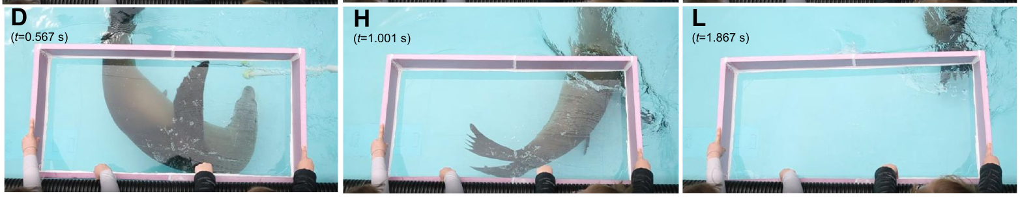
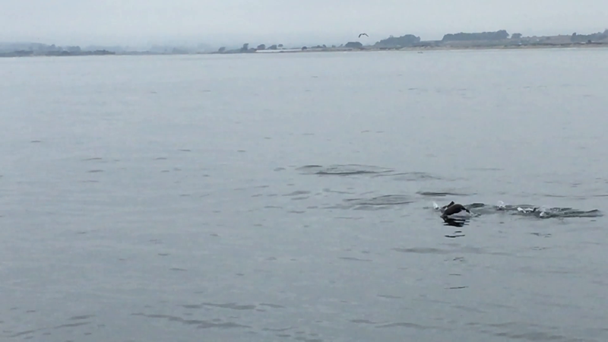
Wild porpoising retains the coordinated movement pattern
Wild California sea lions in Monterey Bay also executed repeated porpoising leaps. The field recordings and the trained-animal recordings supplied different contexts for the same broad locomotor pattern. Both involved alternating aerial movement with submerged propulsion and a changing hindflipper posture.
In the field sequence, the legs generally remained more extended during the aerial phase, and the hindflippers cleared the water. The reported average leap length was 0.81 body lengths and the aerial height was 0.06 body lengths. Expressing distances in body lengths permits comparison across differently sized animals.
The captive sea lion made longer and higher leaps and used a different entry angle. Training conditions can therefore change the scale of a movement without eliminating the coordinated pattern. The original field movie supplies the natural locomotor comparison; these measurements concern body control rather than synchronization to an acoustic pulse.
Leahy et al. (2021), Fig. 3D, H, L. Changing flipper configuration during a maneuver.
Leahy et al. (2021), Movie 2. Wild sea lions porpoise in Monterey Bay.
Leahy et al. (2021)
15
Notes:
• Wild California sea lions in Monterey Bay also executed repeated porpoising leaps. The field recordings and the trained-animal recordings supplied different contexts for the same broad locomotor pattern. Both involved alternating aerial movement with submerged propulsion and a changing hindflipper posture.
• In the field sequence, the legs generally remained more extended during the aerial phase, and the hindflippers cleared the water. The reported average leap length was 0.81 body lengths and the aerial height was 0.06 body lengths. Expressing distances in body lengths permits comparison across differently sized animals.
• The captive sea lion made longer and higher leaps and used a different entry angle. Training conditions can therefore change the scale of a movement without eliminating the coordinated pattern. The original field movie supplies the natural locomotor comparison; these measurements concern body control rather than synchronization to an acoustic pulse.
References:
Leahy AM, Fish FE, Kerr SJ, Zeligs JA, Skrovan S, Cardenas KL, Leftwich MC (2021). The role of California sea lion (Zalophus californianus) hindflippers as aquatic control surfaces for maneuverability. Journal of Experimental Biology 224(20):jeb243020. https://doi.org/10.1242/jeb.243020
Figure: Leahy et al. (2021), Fig. 3D, H, L. Changing flipper configuration during a maneuver.
Figure source: https://doi.org/10.1242/jeb.243020
Embedded recording: Leahy et al. (2021), Movie 2. Wild sea lions porpoise in Monterey Bay.
Source URL: https://static-movie-usa.glencoesoftware.com/source/10.1242/738/918c6b425b28fbbb9ac7bd4aafad3298129ba4a7/JEB243020.MovieS2.mp4
Article DOI: https://doi.org/10.1242/jeb.243020
Credit: Leahy, Fish, Kerr, Zeligs, Skrovan, Cardenas, and Leftwich. License: Copyright The Company of Biologists; no open license stated.
Discuss the displayed behavior and compare it with the adjacent published measurements. Original timing and audio retained; poster is an unedited frame. The embedded MP4 preserves native display proportions, original timing, scene order, and audio; compatibility conversion details are recorded in media_conversion_audit.json when applicable. Desktop PowerPoint playback and Google Slides import were not tested.

Slide 16
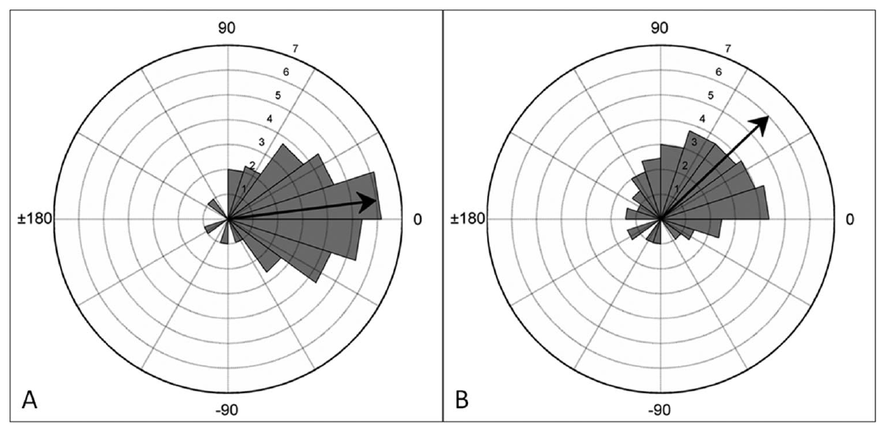
Musical pulse guides movement beyond the training sound
A musical recording contains overlapping instruments and events between the regular beats. Ronan coordinated her head movements with Everybody at about 108 bpm and Boogie Wonderland at 130 bpm. Keeping the repeated response organized required selecting a temporal regularity within this more complex acoustic material.
The songs had different exposure histories. Everybody received explicit training after earlier unsuccessful exposure. Boogie Wonderland had been heard briefly before the later transfer test, without that exposure producing entrained bobbing. Prior exposure and reinforced successful performance are distinct learning events.
After training at the native tempo of Boogie Wonderland, Ronan also followed altered versions spanning 104–143 bpm. The same musical material guided different movement rates. Flexibility across these versions links the trained action to the current pulse instead of one fixed speed learned from a familiar recording.
Cook et al. (2013), Fig. 4A–B. Head-bob timing with Everybody and Boogie Wonderland.
Cook et al. (2013)
16
Notes:
• A musical recording contains overlapping instruments and events between the regular beats. Ronan coordinated her head movements with Everybody at about 108 bpm and Boogie Wonderland at 130 bpm. Keeping the repeated response organized required selecting a temporal regularity within this more complex acoustic material.
• The songs had different exposure histories. Everybody received explicit training after earlier unsuccessful exposure. Boogie Wonderland had been heard briefly before the later transfer test, without that exposure producing entrained bobbing. Prior exposure and reinforced successful performance are distinct learning events.
• After training at the native tempo of Boogie Wonderland, Ronan also followed altered versions spanning 104–143 bpm. The same musical material guided different movement rates. Flexibility across these versions links the trained action to the current pulse instead of one fixed speed learned from a familiar recording.
References:
Cook PF, Rouse A, Wilson M, Reichmuth C (2013). A California sea lion (Zalophus californianus) can keep the beat: Motor entrainment to rhythmic auditory stimuli in a non vocal mimic. Journal of Comparative Psychology 127(4): 412–427. https://doi.org/10.1037/a0032345
Figure: Cook et al. (2013), Fig. 4A–B. Head-bob timing with Everybody and Boogie Wonderland.
Figure source: https://doi.org/10.1037/a0032345

Slide 17
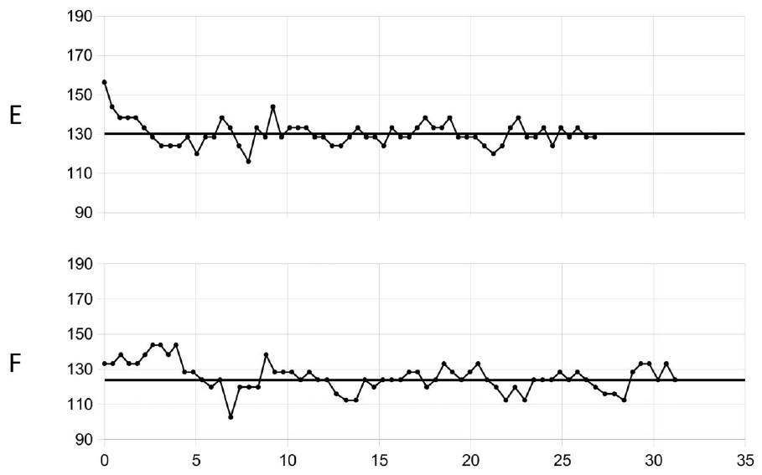
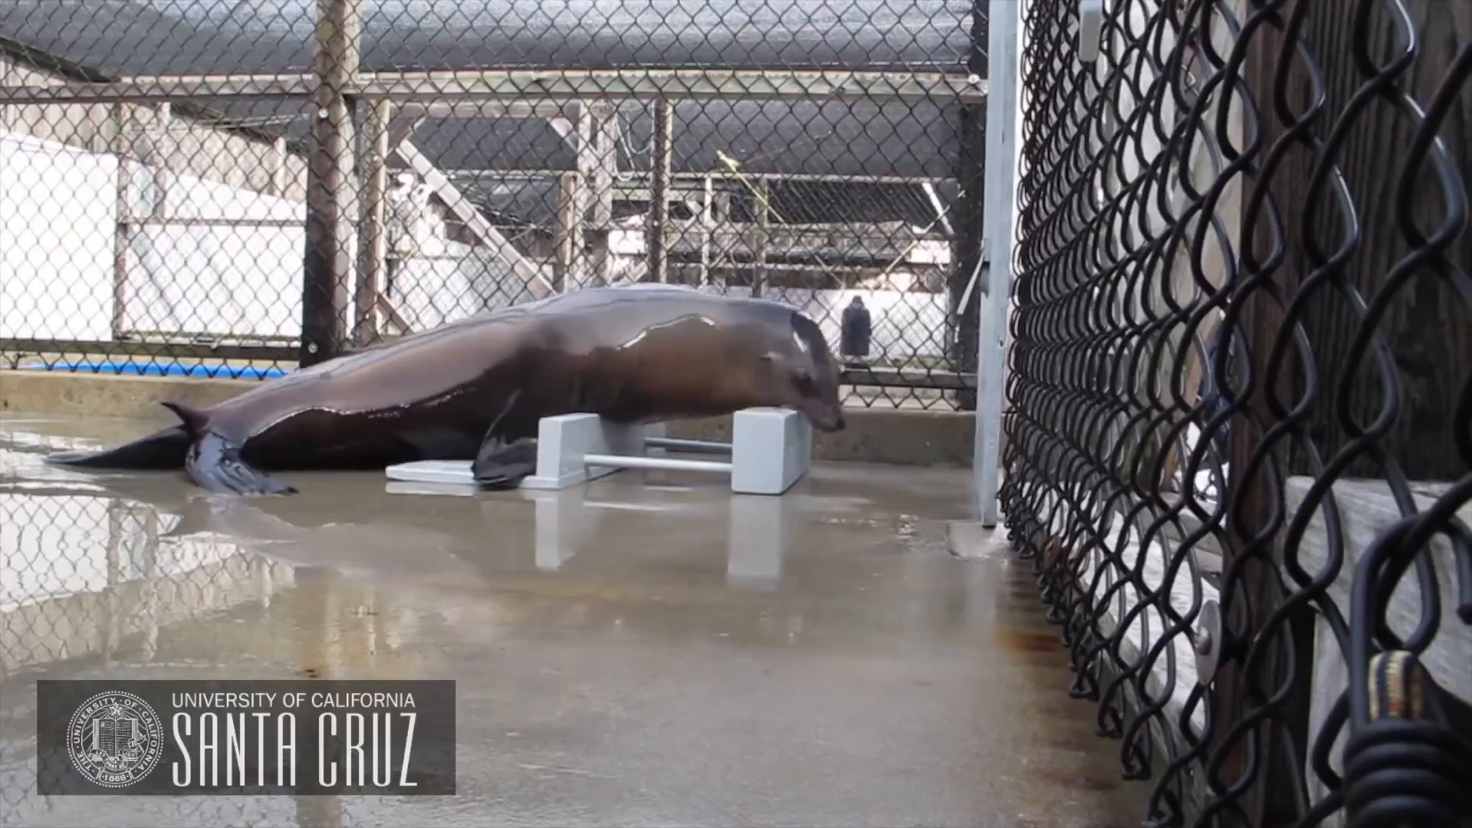
A dancing reputation rests on controlled experiments
The public description of Ronan as a dancing sea lion refers to a trained head-bob response measured against sound timing. Her scientific contribution was not simply that she moved while music played, but that her movement adapted across rates and persisted through controlled tests.
Novel tempos, musical recordings, silent omissions, and extended trials each challenged a different simple explanation of the behavior. Together they connected the repeating motor response to temporal regularities that varied independently of the original two training examples.
Ronan’s study site was Long Marine Laboratory at UC Santa Cruz. The original researchers’ recordings are the relevant evidence for her timing performance; a publicity recording supplies behavioral context, while quantified trial measurements establish the accuracy, consistency, and transfer of that coordination.
Cook et al. (2013), Fig. 6E–F. Extended coordination with music at 137 and 124 bpm.
Cook et al. (2013), official UCSC study video. Ronan transfers trained synchronization to music.
Cook et al. (2013)
17
Notes:
• The public description of Ronan as a dancing sea lion refers to a trained head-bob response measured against sound timing. Her scientific contribution was not simply that she moved while music played, but that her movement adapted across rates and persisted through controlled tests.
• Novel tempos, musical recordings, silent omissions, and extended trials each challenged a different simple explanation of the behavior. Together they connected the repeating motor response to temporal regularities that varied independently of the original two training examples.
• Ronan’s study site was Long Marine Laboratory at UC Santa Cruz. The original researchers’ recordings are the relevant evidence for her timing performance; a publicity recording supplies behavioral context, while quantified trial measurements establish the accuracy, consistency, and transfer of that coordination.
References:
Cook PF, Rouse A, Wilson M, Reichmuth C (2013). A California sea lion (Zalophus californianus) can keep the beat: Motor entrainment to rhythmic auditory stimuli in a non vocal mimic. Journal of Comparative Psychology 127(4): 412–427. https://doi.org/10.1037/a0032345
Figure: Cook et al. (2013), Fig. 6E–F. Extended coordination with music at 137 and 124 bpm.
Figure source: https://doi.org/10.1037/a0032345
Embedded recording: Cook et al. (2013), official UCSC study video. Ronan transfers trained synchronization to music.
Source URL: https://youtu.be/s4nBevZJMvk
Article DOI: https://doi.org/10.1037/a0032345
Credit: UC Santa Cruz; Cook and colleagues. License: No open license stated; instructor-provided compressed copy and explicit permission for this official study video.
Discuss the displayed behavior and compare it with the adjacent published measurements. Original timing and audio retained; poster is an unedited frame. The embedded MP4 preserves native display proportions, original timing, scene order, and audio; compatibility conversion details are recorded in media_conversion_audit.json when applicable. Desktop PowerPoint playback and Google Slides import were not tested.

Slide 18
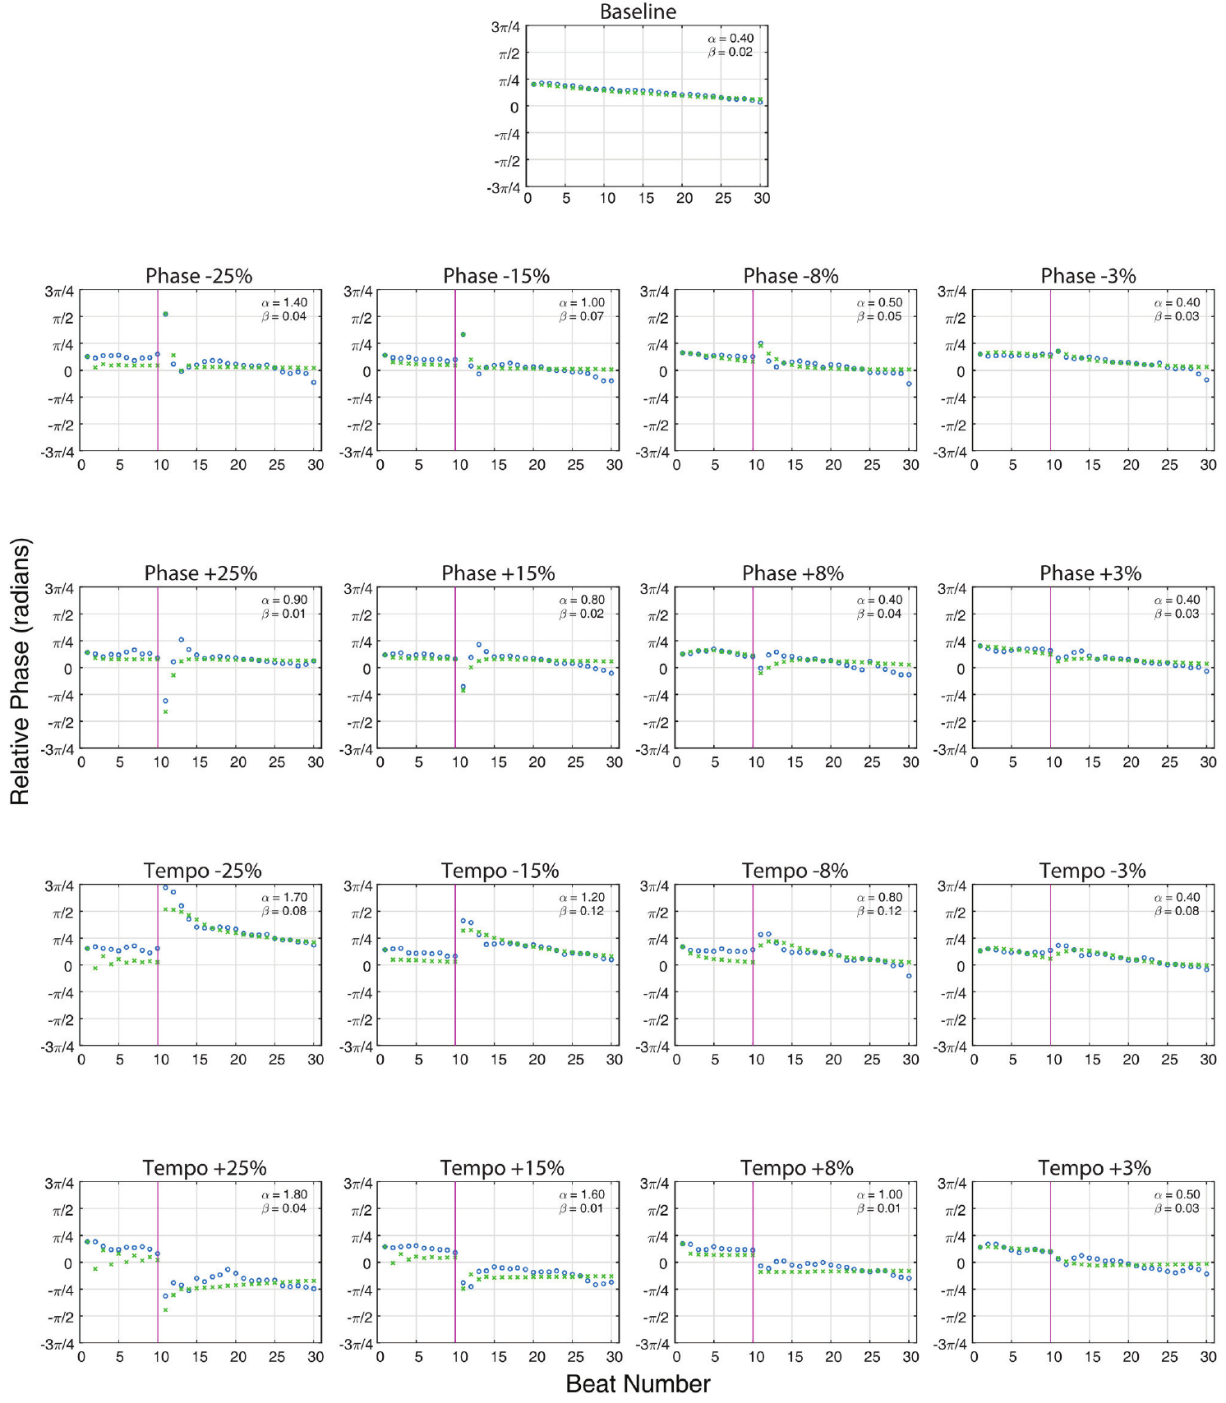
Perturbations separate phase from period correction
A phase perturbation shifts where the sound sequence falls in time while preserving its eventual repetition rate. A tempo perturbation changes the interval between successive sounds. These manipulations challenge different components of an already coordinated movement.
Rouse and colleagues introduced one unexpected change during a trial, after a stable initial run of beats. Ronan then had to modify the movement she was already producing. The response immediately after the change exposed the dynamics of correction.
Period is the duration of one complete cycle. A repeating motor process can correct timing position quickly while changing its preferred period more slowly. Comparing phase and tempo perturbations therefore tested a coupled-oscillator hypothesis: the sound sequence influences a repeating movement process, or oscillator. Transient behavior measures how ongoing coordination changes after an unexpected timing disturbance.
Rouse et al. (2016), Fig. 3. Responses to mid-trial timing changes.
Rouse et al. (2016)
18
Notes:
• A **phase perturbation** shifts where the sound sequence falls in time while preserving its eventual repetition rate. A **tempo perturbation** changes the interval between successive sounds. These manipulations challenge different components of an already coordinated movement.
• Rouse and colleagues introduced one unexpected change during a trial, after a stable initial run of beats. Ronan then had to modify the movement she was already producing. The response immediately after the change exposed the dynamics of correction.
• **Period** is the duration of one complete cycle. A repeating motor process can correct timing position quickly while changing its preferred period more slowly. Comparing phase and tempo perturbations therefore tested a coupled-oscillator hypothesis: the sound sequence influences a repeating movement process, or **oscillator**. Transient behavior measures how ongoing coordination changes after an unexpected timing disturbance.
References:
Rouse AA, Cook PF, Large EW, Reichmuth C (2016). Beat Keeping in a Sea Lion As Coupled Oscillation: Implications for Comparative Understanding of Human Rhythm. Frontiers in Neuroscience 10:257. https://doi.org/10.3389/fnins.2016.00257
Figure: Rouse et al. (2016), Fig. 3. Responses to mid-trial timing changes.
Figure source: https://doi.org/10.3389/fnins.2016.00257

Slide 19
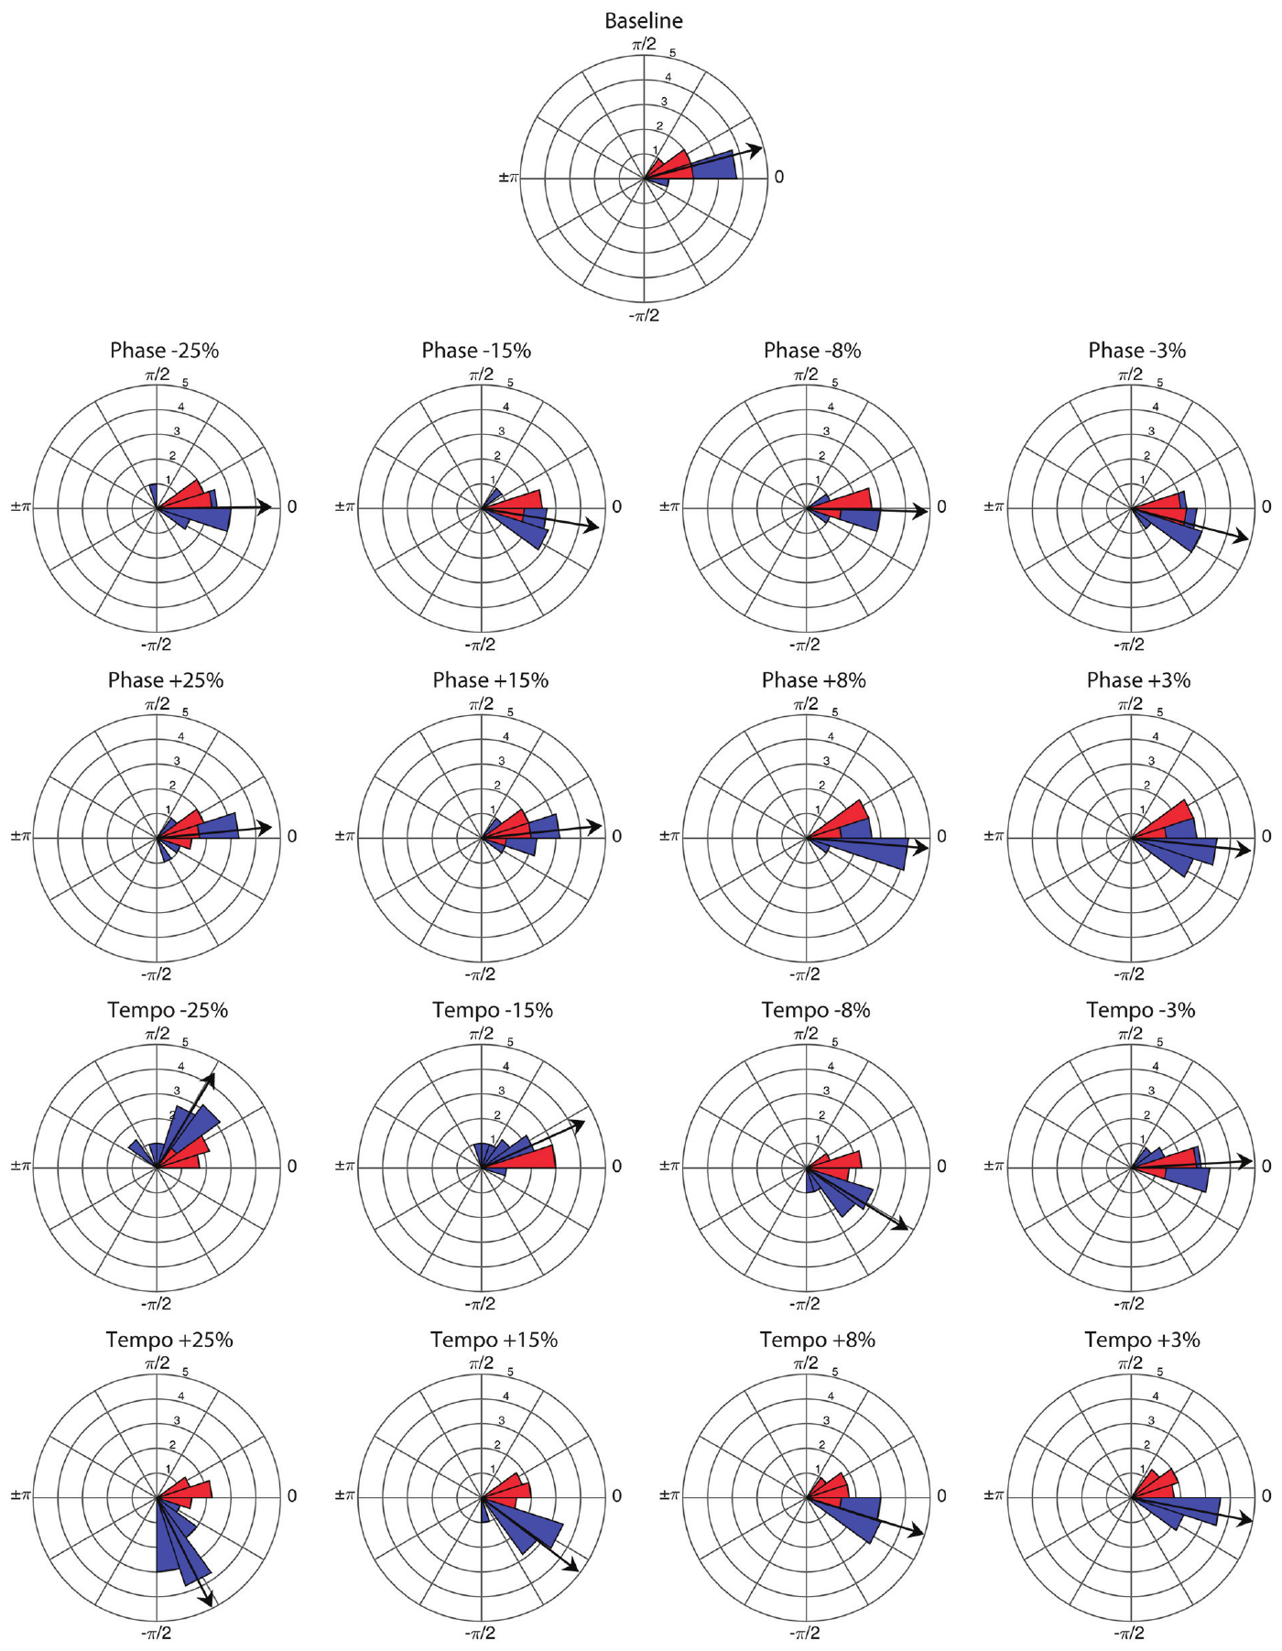
The perturbation stimulus uses brief paired tones
The stimulus clicks combined tones at 659 and 1319 Hz for 10 ms. Repeating these brief events created a clear temporal sequence. The main baseline rate was 85 bpm, a rate Ronan had not previously encountered in training or testing.
Perturbations changed a timing interval by 3, 8, 15, or 25 percent in either direction. The change occurred between the sixteenth and twenty-fifth beat, with its position varied across conditions so that a fixed point in the sequence would not predict it.
At the baseline rate, the normal interval was about 706 ms. Controlled changes to that interval introduced experimentally specified timing errors into a sequence that Ronan was already following, allowing the subsequent head bobs to reveal how she recovered coordination.
Rouse et al. (2016), Fig. 1. Phase distributions before and after timing changes.
Rouse et al. (2016)
19
Notes:
• The stimulus clicks combined tones at 659 and 1319 Hz for 10 ms. Repeating these brief events created a clear temporal sequence. The main baseline rate was 85 bpm, a rate Ronan had not previously encountered in training or testing.
• Perturbations changed a timing interval by 3, 8, 15, or 25 percent in either direction. The change occurred between the sixteenth and twenty-fifth beat, with its position varied across conditions so that a fixed point in the sequence would not predict it.
• At the baseline rate, the normal interval was about 706 ms. Controlled changes to that interval introduced experimentally specified timing errors into a sequence that Ronan was already following, allowing the subsequent head bobs to reveal how she recovered coordination.
References:
Rouse AA, Cook PF, Large EW, Reichmuth C (2016). Beat Keeping in a Sea Lion As Coupled Oscillation: Implications for Comparative Understanding of Human Rhythm. Frontiers in Neuroscience 10:257. https://doi.org/10.3389/fnins.2016.00257
Figure: Rouse et al. (2016), Fig. 1. Phase distributions before and after timing changes.
Figure source: https://doi.org/10.3389/fnins.2016.00257

Slide 20
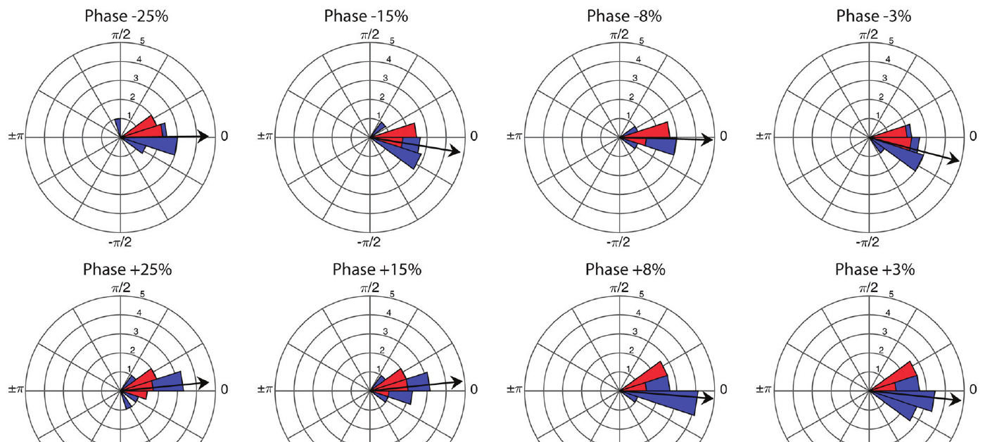
A phase shift moves the beat without a new tempo
In a phase-shift trial, a sound occurs earlier or later than expected, but later sounds return to the original spacing. The stimulus’s temporal position changes while its continuing tempo remains fixed, separating an onset-position error from a lasting change in speed.
Ronan adjusted her head-bob timing after both advances and delays. Her movement regained an organized relationship with the shifted sequence within a few beats, rather than staying locked to the timing established before the perturbation.
This recovery is phase correction, the adjustment of an ongoing cycle’s position relative to an external event. Because the subsequent sound interval returns to baseline, successful recovery can be achieved by a transient movement adjustment without adopting a permanently different repetition rate.
Rouse et al. (2016), Fig. 1, phase conditions. Timing distributions after phase advances and delays.
Rouse et al. (2016)
20
Notes:
• In a phase-shift trial, a sound occurs earlier or later than expected, but later sounds return to the original spacing. The stimulus’s temporal position changes while its continuing tempo remains fixed, separating an onset-position error from a lasting change in speed.
• Ronan adjusted her head-bob timing after both advances and delays. Her movement regained an organized relationship with the shifted sequence within a few beats, rather than staying locked to the timing established before the perturbation.
• This recovery is **phase correction**, the adjustment of an ongoing cycle’s position relative to an external event. Because the subsequent sound interval returns to baseline, successful recovery can be achieved by a transient movement adjustment without adopting a permanently different repetition rate.
References:
Rouse AA, Cook PF, Large EW, Reichmuth C (2016). Beat Keeping in a Sea Lion As Coupled Oscillation: Implications for Comparative Understanding of Human Rhythm. Frontiers in Neuroscience 10:257. https://doi.org/10.3389/fnins.2016.00257
Figure: Rouse et al. (2016), Fig. 1, phase conditions. Timing distributions after phase advances and delays.
Figure source: https://doi.org/10.3389/fnins.2016.00257

Slide 21
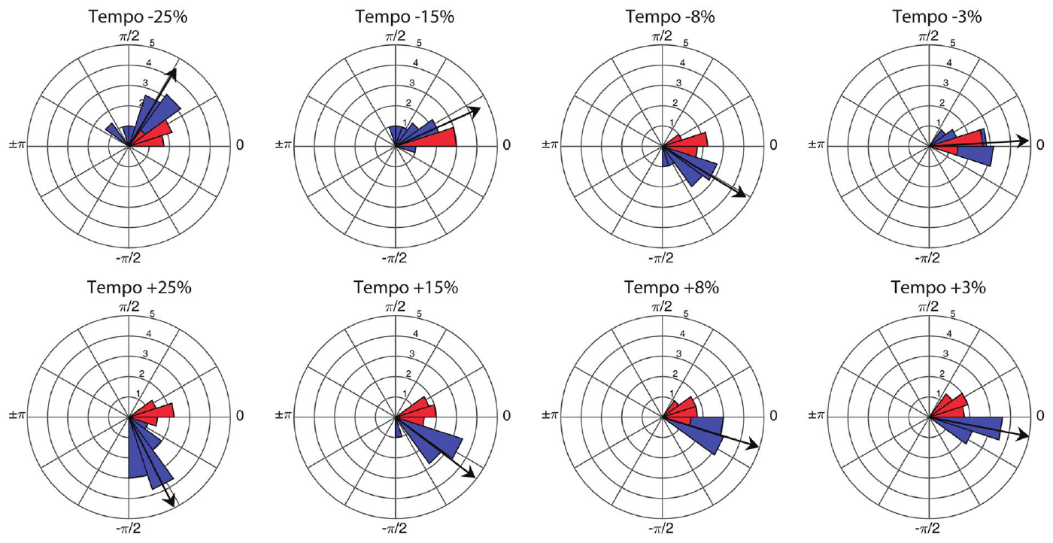
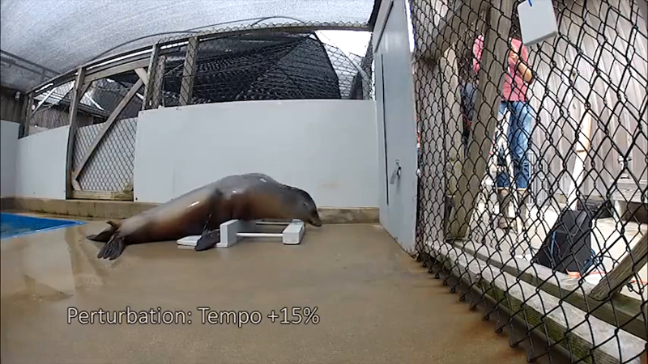
A tempo shift changes every later sound interval
A tempo perturbation alters the spacing of every subsequent beat. If the head-bob rhythm kept its original period, the relative position of movement and sound would drift increasingly across the trial, even after the first timing error had been corrected.
Ronan adapted after all the tested tempo changes. The response had to address the continuing mismatch in cycle duration, not merely the placement of a single unexpectedly early or late sound within an otherwise unchanged sequence.
The authors’ sign convention referred to interval length: a positive interval change made the beat slower, while a negative change made it faster. Keeping interval and tempo distinct is necessary for interpreting which perturbations required Ronan to slow her repeated movement and which required her to accelerate it.
Rouse et al. (2016), Fig. 1, tempo conditions. Timing distributions after persistent rate changes.
Rouse et al. (2016), Video 1 excerpt. Persistent +15% interval change.
Rouse et al. (2016)
21
Notes:
• A tempo perturbation alters the spacing of every subsequent beat. If the head-bob rhythm kept its original period, the relative position of movement and sound would drift increasingly across the trial, even after the first timing error had been corrected.
• Ronan adapted after all the tested tempo changes. The response had to address the continuing mismatch in cycle duration, not merely the placement of a single unexpectedly early or late sound within an otherwise unchanged sequence.
• The authors’ sign convention referred to interval length: a positive interval change made the beat slower, while a negative change made it faster. Keeping interval and tempo distinct is necessary for interpreting which perturbations required Ronan to slow her repeated movement and which required her to accelerate it.
References:
Rouse AA, Cook PF, Large EW, Reichmuth C (2016). Beat Keeping in a Sea Lion As Coupled Oscillation: Implications for Comparative Understanding of Human Rhythm. Frontiers in Neuroscience 10:257. https://doi.org/10.3389/fnins.2016.00257
Figure: Rouse et al. (2016), Fig. 1, tempo conditions. Timing distributions after persistent rate changes.
Figure source: https://doi.org/10.3389/fnins.2016.00257
Embedded recording: Rouse et al. (2016), Video 1 excerpt. Persistent +15% interval change.
Source URL: https://pmc-oa-opendata.s3.amazonaws.com/PMC4891632.1/Video1.MP4
Article DOI: https://doi.org/10.3389/fnins.2016.00257
Credit: Rouse, Cook, Large, and Reichmuth. License: CC BY 4.0.
Discuss the displayed behavior and compare it with the adjacent published measurements. Original timing and audio retained; poster is an unedited frame. The embedded MP4 preserves native display proportions, original timing, scene order, and audio; compatibility conversion details are recorded in media_conversion_audit.json when applicable. Desktop PowerPoint playback and Google Slides import were not tested.
Instructor-authorized excerpt: 24 to 50 seconds. H264 CRF26; AAC96kbps; no speed change; original frame rate and audio timing retained. Spatial crop: None. This excerpt retains the source behavior and sound sequence; omitted sections are outside the selected task.

Slide 22
The first transfer response already tracks the change
The first presentation of each perturbation provided a test before repeated experience with that exact change. Ronan retained organized movement relative to the beat after these first encounters, including phase changes and persistent changes in the stimulus interval.
The response therefore transferred beyond a repeatedly practiced correction at one fixed perturbation. The animal applied its existing auditory–motor coordination to an unfamiliar mid-trial disturbance, with later sounds continuing to influence the repeating behavioral cycle.
Initial-transfer data and repeated-trial data served different purposes. The former established that correction could appear at first exposure; the latter characterized the consistency and temporal course of correction across presentations, supporting a more detailed model of the behavior’s adjustment dynamics.
Rouse et al. (2016), Fig. 1. First presentations of timing-perturbation conditions.
Rouse et al. (2016)
22
Notes:
• The first presentation of each perturbation provided a test before repeated experience with that exact change. Ronan retained organized movement relative to the beat after these first encounters, including phase changes and persistent changes in the stimulus interval.
• The response therefore transferred beyond a repeatedly practiced correction at one fixed perturbation. The animal applied its existing auditory–motor coordination to an unfamiliar mid-trial disturbance, with later sounds continuing to influence the repeating behavioral cycle.
• Initial-transfer data and repeated-trial data served different purposes. The former established that correction could appear at first exposure; the latter characterized the consistency and temporal course of correction across presentations, supporting a more detailed model of the behavior’s adjustment dynamics.
References:
Rouse AA, Cook PF, Large EW, Reichmuth C (2016). Beat Keeping in a Sea Lion As Coupled Oscillation: Implications for Comparative Understanding of Human Rhythm. Frontiers in Neuroscience 10:257. https://doi.org/10.3389/fnins.2016.00257
Figure: Rouse et al. (2016), Fig. 1. First presentations of timing-perturbation conditions.
Figure source: https://doi.org/10.3389/fnins.2016.00257

Slide 23
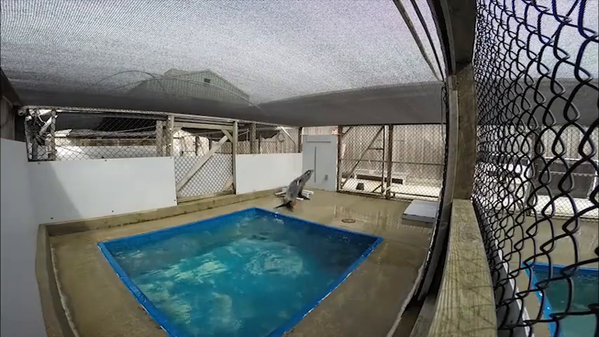
Phase recovery occurs over successive movements
The researchers aligned trials at the perturbation and compared the relative phase of successive head bobs. Before the change, movement and sound were already coordinated. The sudden phase disturbance created a measurable error that could then be followed over later cycles.
Ronan corrected the disturbance within a few beats. Recovery was a trajectory across successive movements rather than an instantaneous switch from one static state to another. This time course supplied information about the strength and direction of adjustment.
The published model predicted these transient trajectories using coupling between the sound sequence and the behavioral oscillator. Coupling means that the timing of one process changes the state of the other; here, the sound events adjusted the timing of the continuing head-bob cycle.
Rouse et al. (2016), Fig. 3. Beat-by-beat recovery after phase changes.
Rouse et al. (2016), Video 1 excerpt. +25% phase disturbance.
Rouse et al. (2016)
23
Notes:
• The researchers aligned trials at the perturbation and compared the relative phase of successive head bobs. Before the change, movement and sound were already coordinated. The sudden phase disturbance created a measurable error that could then be followed over later cycles.
• Ronan corrected the disturbance within a few beats. Recovery was a trajectory across successive movements rather than an instantaneous switch from one static state to another. This time course supplied information about the strength and direction of adjustment.
• The published model predicted these transient trajectories using coupling between the sound sequence and the behavioral oscillator. **Coupling** means that the timing of one process changes the state of the other; here, the sound events adjusted the timing of the continuing head-bob cycle.
References:
Rouse AA, Cook PF, Large EW, Reichmuth C (2016). Beat Keeping in a Sea Lion As Coupled Oscillation: Implications for Comparative Understanding of Human Rhythm. Frontiers in Neuroscience 10:257. https://doi.org/10.3389/fnins.2016.00257
Figure: Rouse et al. (2016), Fig. 3. Beat-by-beat recovery after phase changes.
Figure source: https://doi.org/10.3389/fnins.2016.00257
Embedded recording: Rouse et al. (2016), Video 1 excerpt. +25% phase disturbance.
Source URL: https://pmc-oa-opendata.s3.amazonaws.com/PMC4891632.1/Video1.MP4
Article DOI: https://doi.org/10.3389/fnins.2016.00257
Credit: Rouse, Cook, Large, and Reichmuth. License: CC BY 4.0.
Discuss the displayed behavior and compare it with the adjacent published measurements. Original timing and audio retained; poster is an unedited frame. The embedded MP4 preserves native display proportions, original timing, scene order, and audio; compatibility conversion details are recorded in media_conversion_audit.json when applicable. Desktop PowerPoint playback and Google Slides import were not tested.
Instructor-authorized excerpt: 66 to 84 seconds. H264 CRF26; AAC96kbps; no speed change; original frame rate and audio timing retained. Spatial crop: None. This excerpt retains the source behavior and sound sequence; omitted sections are outside the selected task.

Slide 24
Rate changes produce a lasting timing adjustment
Following a lasting rate change, Ronan’s initial movement period and the new stimulus period differed. Head movements therefore had to adjust across several cycles to approach a stable relationship with the new continuing sound sequence.
The measured trajectories recovered after changes in either direction. A faster stimulus required more rapid movement, whereas a slower stimulus required longer intervals between selected movement landmarks. The correction preserved a regular relationship between sound and action despite the disturbance.
The period component of the coupled-oscillator model represented adjustment to this continuing rate mismatch. Combining period adjustment with phase adjustment improved the fit to the measured recovery trajectories, connecting two distinct timing operations to the transient response produced by the animal.
Rouse et al. (2016), Fig. 3. Recovery trajectories following rate shifts.
Rouse et al. (2016)
24
Notes:
• Following a lasting rate change, Ronan’s initial movement period and the new stimulus period differed. Head movements therefore had to adjust across several cycles to approach a stable relationship with the new continuing sound sequence.
• The measured trajectories recovered after changes in either direction. A faster stimulus required more rapid movement, whereas a slower stimulus required longer intervals between selected movement landmarks. The correction preserved a regular relationship between sound and action despite the disturbance.
• The period component of the coupled-oscillator model represented adjustment to this continuing rate mismatch. Combining period adjustment with phase adjustment improved the fit to the measured recovery trajectories, connecting two distinct timing operations to the transient response produced by the animal.
References:
Rouse AA, Cook PF, Large EW, Reichmuth C (2016). Beat Keeping in a Sea Lion As Coupled Oscillation: Implications for Comparative Understanding of Human Rhythm. Frontiers in Neuroscience 10:257. https://doi.org/10.3389/fnins.2016.00257
Figure: Rouse et al. (2016), Fig. 3. Recovery trajectories following rate shifts.
Figure source: https://doi.org/10.3389/fnins.2016.00257

Slide 25
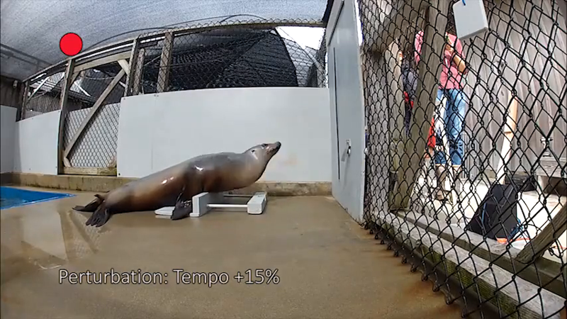
A double bob exposes an immediate motor adjustment
During some large slowing perturbations, the next sound occurred when Ronan’s head was near the high point of a movement rather than its low point. She sometimes made an additional small nod before slowing the broader movement cycle.
The authors called these responses double bobs because two identifiable movements occurred around a beat. Their observation connected the timing disturbance with a specific change in movement form, rather than treating all behavior as identical cycles with only altered timestamps.
These unusual nods were excluded from the primary cycle-timing analysis and documented in Supplementary Video 1. Their occurrence is still informative behavioral material: an unexpected sound can modify both the timing of a repeated action and the shape of the immediate motor response.
Rouse et al. (2016), Fig. 3. Behavioral timing after persistent interval changes.
Rouse et al. (2016), Video 1 excerpt. +25% interval change and extra nod.
Rouse et al. (2016)
25
Notes:
• During some large slowing perturbations, the next sound occurred when Ronan’s head was near the high point of a movement rather than its low point. She sometimes made an additional small nod before slowing the broader movement cycle.
• The authors called these responses **double bobs** because two identifiable movements occurred around a beat. Their observation connected the timing disturbance with a specific change in movement form, rather than treating all behavior as identical cycles with only altered timestamps.
• These unusual nods were excluded from the primary cycle-timing analysis and documented in Supplementary Video 1. Their occurrence is still informative behavioral material: an unexpected sound can modify both the timing of a repeated action and the shape of the immediate motor response.
References:
Rouse AA, Cook PF, Large EW, Reichmuth C (2016). Beat Keeping in a Sea Lion As Coupled Oscillation: Implications for Comparative Understanding of Human Rhythm. Frontiers in Neuroscience 10:257. https://doi.org/10.3389/fnins.2016.00257
Figure: Rouse et al. (2016), Fig. 3. Behavioral timing after persistent interval changes.
Figure source: https://doi.org/10.3389/fnins.2016.00257
Embedded recording: Rouse et al. (2016), Video 1 excerpt. +25% interval change and extra nod.
Source URL: https://pmc-oa-opendata.s3.amazonaws.com/PMC4891632.1/Video1.MP4
Article DOI: https://doi.org/10.3389/fnins.2016.00257
Credit: Rouse, Cook, Large, and Reichmuth. License: CC BY 4.0.
Discuss the displayed behavior and compare it with the adjacent published measurements. Original timing and audio retained; poster is an unedited frame. The embedded MP4 preserves native display proportions, original timing, scene order, and audio; compatibility conversion details are recorded in media_conversion_audit.json when applicable. Desktop PowerPoint playback and Google Slides import were not tested.
Instructor-authorized excerpt: 50 to 62 seconds. H264 CRF26; AAC96kbps; no speed change; original frame rate and audio timing retained. Spatial crop: None. This excerpt retains the source behavior and sound sequence; omitted sections are outside the selected task.

Slide 26
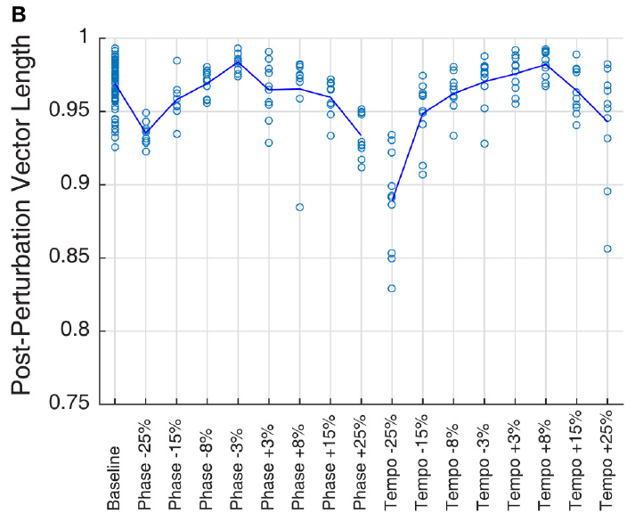
Timing concentration and timing offset are separate
A series of movements can be consistently early, consistently late, or widely scattered around the beat. The average phase describes the center of that relationship, whereas the concentration of phases describes how consistently successive movements occupy that position.
Ronan’s post-perturbation phases were tightly concentrated across the tested conditions. Some conditions nevertheless retained systematic offsets. High consistency therefore describes reliable coordination with the sequence and does not automatically mean that the chosen movement landmark coincides exactly with sound onset.
The researchers evaluated these properties separately because different aspects of the timing process influence them. Correcting a disturbance may stabilize a relationship before eliminating its offset, and a repeating behavioral process can remain strongly coordinated while occupying a stable position ahead of or behind the sound.
Rouse et al. (2016), Fig. 2B. Consistency of beat-relative movement timing.
Rouse et al. (2016)
26
Notes:
• A series of movements can be consistently early, consistently late, or widely scattered around the beat. The average phase describes the center of that relationship, whereas the concentration of phases describes how consistently successive movements occupy that position.
• Ronan’s post-perturbation phases were tightly concentrated across the tested conditions. Some conditions nevertheless retained systematic offsets. High consistency therefore describes reliable coordination with the sequence and does not automatically mean that the chosen movement landmark coincides exactly with sound onset.
• The researchers evaluated these properties separately because different aspects of the timing process influence them. Correcting a disturbance may stabilize a relationship before eliminating its offset, and a repeating behavioral process can remain strongly coordinated while occupying a stable position ahead of or behind the sound.
References:
Rouse AA, Cook PF, Large EW, Reichmuth C (2016). Beat Keeping in a Sea Lion As Coupled Oscillation: Implications for Comparative Understanding of Human Rhythm. Frontiers in Neuroscience 10:257. https://doi.org/10.3389/fnins.2016.00257
Figure: Rouse et al. (2016), Fig. 2B. Consistency of beat-relative movement timing.
Figure source: https://doi.org/10.3389/fnins.2016.00257

Slide 27
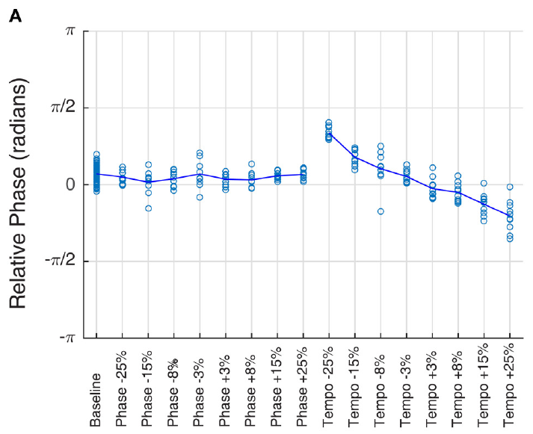
The stable phase varies with the new tempo
Phase changes and tempo changes produced different patterns after recovery. Under phase perturbations, the long-term stimulus rate returned to its original value. Under tempo perturbations, the ongoing sound interval remained altered, creating a new continuing rate relationship.
Ronan’s average post-perturbation phase varied systematically with the altered tempo. Slower and faster conditions therefore retained distinct timing positions even when the head movements had regained a consistent relationship with the continuing sequence.
This phase–tempo relationship matched a pattern seen in the earlier transfer experiments. The repeated finding linked stable coordination across unfamiliar tempos with the transient correction of a sudden rate change, giving a common behavioral constraint for the oscillator model to explain.
Rouse et al. (2016), Fig. 2A. Average offsets after phase and tempo perturbations.
Rouse et al. (2016)
27
Notes:
• Phase changes and tempo changes produced different patterns after recovery. Under phase perturbations, the long-term stimulus rate returned to its original value. Under tempo perturbations, the ongoing sound interval remained altered, creating a new continuing rate relationship.
• Ronan’s average post-perturbation phase varied systematically with the altered tempo. Slower and faster conditions therefore retained distinct timing positions even when the head movements had regained a consistent relationship with the continuing sequence.
• This phase–tempo relationship matched a pattern seen in the earlier transfer experiments. The repeated finding linked stable coordination across unfamiliar tempos with the transient correction of a sudden rate change, giving a common behavioral constraint for the oscillator model to explain.
References:
Rouse AA, Cook PF, Large EW, Reichmuth C (2016). Beat Keeping in a Sea Lion As Coupled Oscillation: Implications for Comparative Understanding of Human Rhythm. Frontiers in Neuroscience 10:257. https://doi.org/10.3389/fnins.2016.00257
Figure: Rouse et al. (2016), Fig. 2A. Average offsets after phase and tempo perturbations.
Figure source: https://doi.org/10.3389/fnins.2016.00257

Slide 28
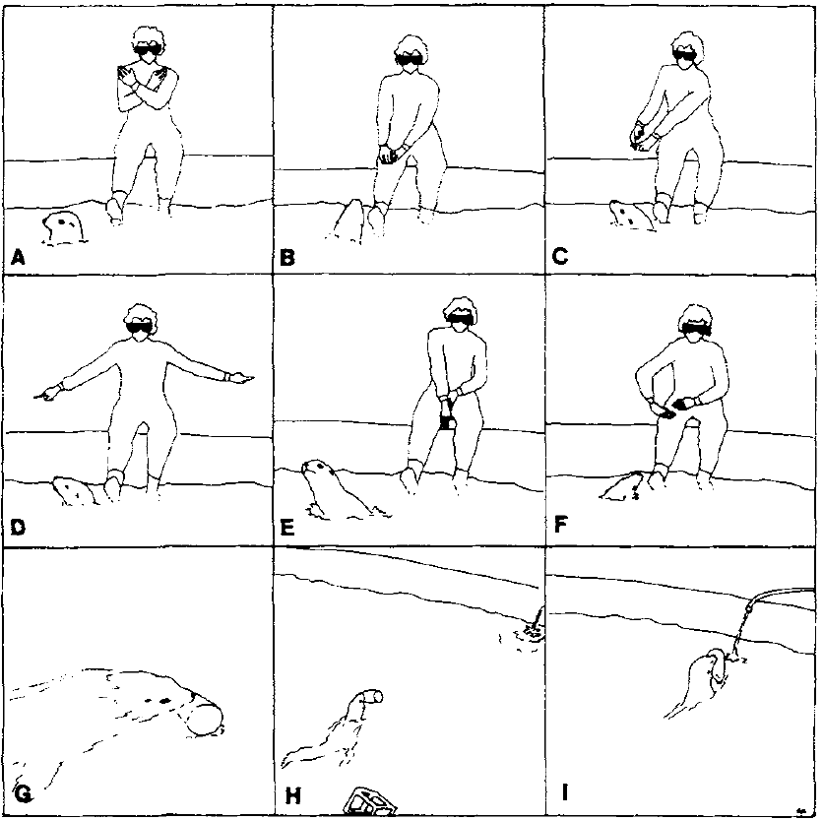
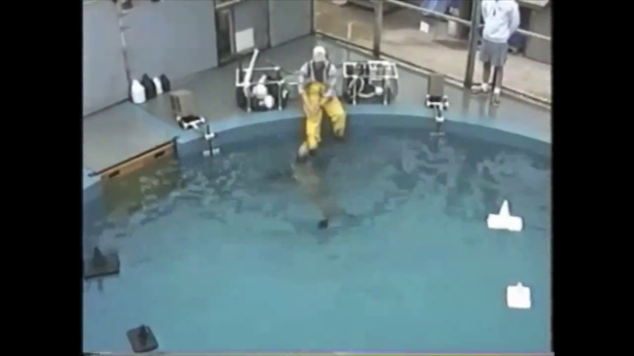
Sign order controls object-directed actions
Rocky, a California sea lion, learned hand signs that specified objects, their attributes, and actions. A standard instruction could designate a destination, pause, identify an object by modifiers, and request transport. Conditional discrimination means that the appropriate response depends on the preceding cues as well as the currently available objects.
Gisiner and Schusterman recorded orienting during each sign and the final action after a release cue. During 70 anomalous-order probes, 62 orienting responses followed the previously learned sequential rules. The final responses included 55 refusals to complete the command and 15 partial actions.
A modifier narrowed which object Rocky should select, whereas an action sign specified what to do with it. Reordering familiar signs changed the behavior despite retaining familiar components. The experiment connected learned cue order with visual search, waiting at the station, and object-directed movement.
Gisiner and Schusterman (1992), Fig. 1A–I. Rocky follows object, modifier, and action signs.
Cook et al. (2021), Video 17.1 excerpt. Rocky follows the LARGE BALL, WATERWING, FETCH sequence.
Gisiner and Schusterman (1992)
28
Notes:
• Rocky, a California sea lion, learned hand signs that specified objects, their attributes, and actions. A standard instruction could designate a destination, pause, identify an object by modifiers, and request transport. **Conditional discrimination** means that the appropriate response depends on the preceding cues as well as the currently available objects.
• Gisiner and Schusterman recorded orienting during each sign and the final action after a release cue. During 70 anomalous-order probes, 62 orienting responses followed the previously learned sequential rules. The final responses included 55 refusals to complete the command and 15 partial actions.
• A modifier narrowed which object Rocky should select, whereas an action sign specified what to do with it. Reordering familiar signs changed the behavior despite retaining familiar components. The experiment connected learned cue order with visual search, waiting at the station, and object-directed movement.
References:
Gisiner R, Schusterman RJ (1992). Sequence, syntax, and semantics: Responses of a language-trained sea lion (Zalophus californianus) to novel sign combinations. Journal of Comparative Psychology 106(1):78–91. https://doi.org/10.1037/0735-7036.106.1.78
Cook PF, Reichmuth C, Hanke FD (2021). The Mind of a Sea Lion. In: The Brain of the Marine Mammal. https://doi.org/10.1007/978-3-030-59184-7_17. Supplementary recordings 17.1–17.3 accompany this chapter and depict the trained procedures, not necessarily the specific published test trials.
Figure: Gisiner and Schusterman (1992), Fig. 1A–I. Rocky follows object, modifier, and action signs.
Figure source: https://doi.org/10.1037/0735-7036.106.1.78
Embedded recording: Cook et al. (2021), Video 17.1 excerpt. Rocky follows the LARGE BALL, WATERWING, FETCH sequence.
Source URL: https://e.video-cdn.net/watch?video-id=Av4gjJyizuXyK9pEqPV3Rs&player-id=-qZL2aSgACrhe2fEUstC_v&channel-id=86512
Article DOI: https://doi.org/10.1007/978-3-030-59184-7_17
Credit: Cook, Reichmuth, and Hanke. License: No open license stated.
Discuss the displayed behavior and compare it with the adjacent published measurements. Original timing and audio retained; poster is an unedited frame. The embedded MP4 preserves native display proportions, original timing, scene order, and audio; compatibility conversion details are recorded in media_conversion_audit.json when applicable. Desktop PowerPoint playback and Google Slides import were not tested.
Instructor-authorized excerpt: 51 to 77 seconds. H264 CRF26; AAC96kbps; no speed change; original frame rate and audio timing retained; final delivery H264 CRF30, proportional width capped at 1280 px, no frame-rate or speed change. Spatial crop: None. This excerpt retains the source behavior and sound sequence; omitted sections are outside the selected task.
The chapter supplement records the trained task. It is not identified as a trial from the earlier article; numerical findings refer to that cited article.

Slide 29
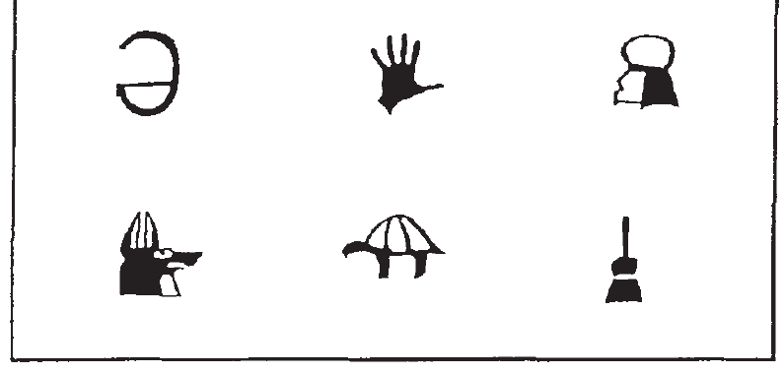
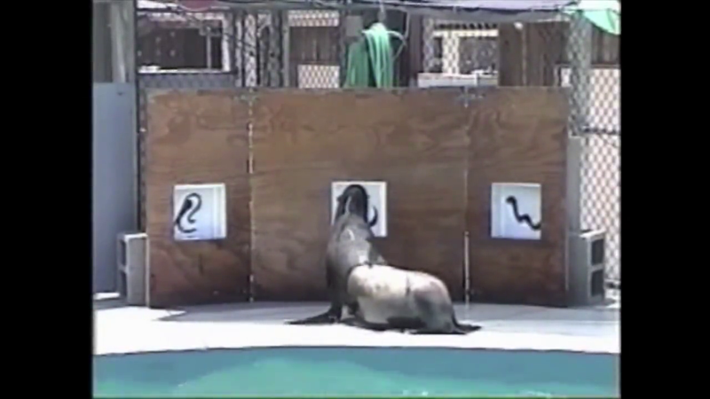
Identity matching transfers to unfamiliar shapes
Matching-to-sample is a choice task in which an initial sample determines the correct comparison. In identity matching, the correct comparison has the same appearance as the sample. Rocky and Rio viewed a sample for approximately 4 s before the two comparison windows opened; a release cue followed after another 2–4 s.
Kastak and Schusterman trained 15 two-stimulus problems and then tested 15 novel problems. Training required 90% correct choices over two consecutive sessions. Correct comparison positions were balanced between left and right, preventing a fixed side response from solving the task.
One sea lion met all transfer criteria on the second test and the other on the third. Both subsequently applied identity matching to stimuli learned previously under different arbitrary matching relations. The learned relationship between sample and choice could therefore guide action when the particular stimulus combination changed.
Kastak and Schusterman (1994), Fig. 1. Six configurations used for visual identity matching.
Cook et al. (2021), Video 17.2 excerpt. Rio performs visual identity matching.
Kastak and Schusterman (1994)
29
Notes:
• **Matching-to-sample** is a choice task in which an initial sample determines the correct comparison. In identity matching, the correct comparison has the same appearance as the sample. Rocky and Rio viewed a sample for approximately 4 s before the two comparison windows opened; a release cue followed after another 2–4 s.
• Kastak and Schusterman trained 15 two-stimulus problems and then tested 15 novel problems. Training required 90% correct choices over two consecutive sessions. Correct comparison positions were balanced between left and right, preventing a fixed side response from solving the task.
• One sea lion met all transfer criteria on the second test and the other on the third. Both subsequently applied identity matching to stimuli learned previously under different arbitrary matching relations. The learned relationship between sample and choice could therefore guide action when the particular stimulus combination changed.
References:
Kastak D, Schusterman RJ (1994). Transfer of visual identity matching-to-sample in two California sea lions (Zalophus californianus). Animal Learning & Behavior 22(4):427–435. https://doi.org/10.3758/BF03209162
Cook PF, Reichmuth C, Hanke FD (2021). The Mind of a Sea Lion. In: The Brain of the Marine Mammal. https://doi.org/10.1007/978-3-030-59184-7_17. Supplementary recordings 17.1–17.3 accompany this chapter and depict the trained procedures, not necessarily the specific published test trials.
Figure: Kastak and Schusterman (1994), Fig. 1. Six configurations used for visual identity matching.
Figure source: https://doi.org/10.3758/BF03209162
Embedded recording: Cook et al. (2021), Video 17.2 excerpt. Rio performs visual identity matching.
Source URL: https://e.video-cdn.net/watch?video-id=6t9bp_2EXpiiKeBUT4Rt3w&player-id=-qZL2aSgACrhe2fEUstC_v&channel-id=86512
Article DOI: https://doi.org/10.1007/978-3-030-59184-7_17
Credit: Cook, Reichmuth, and Hanke. License: No open license stated.
Discuss the displayed behavior and compare it with the adjacent published measurements. Original timing and audio retained; poster is an unedited frame. The embedded MP4 preserves native display proportions, original timing, scene order, and audio; compatibility conversion details are recorded in media_conversion_audit.json when applicable. Desktop PowerPoint playback and Google Slides import were not tested.
Instructor-authorized excerpt: 2 to 43 seconds. H264 CRF26; AAC96kbps; no speed change; original frame rate and audio timing retained; final delivery H264 CRF30, proportional width capped at 1280 px, no frame-rate or speed change. Spatial crop: None. This excerpt retains the source behavior and sound sequence; omitted sections are outside the selected task.
The chapter supplement records the trained task. It is not identified as a trial from the earlier article; numerical findings refer to that cited article.

Slide 30
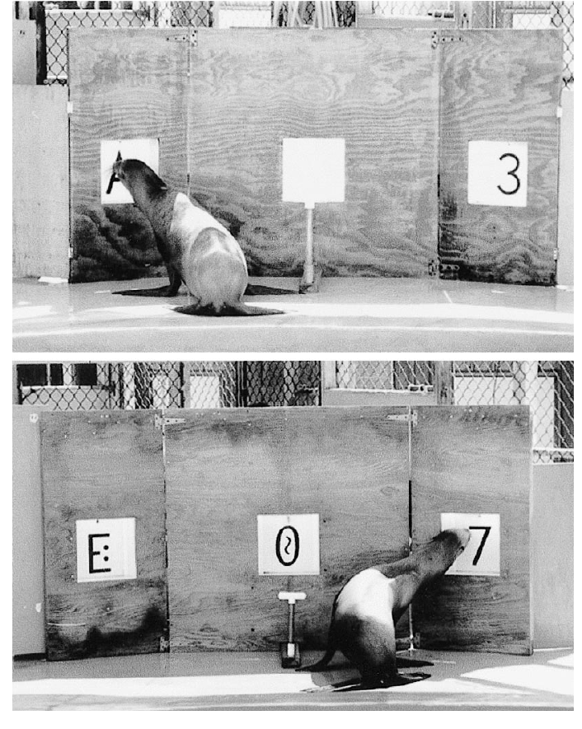
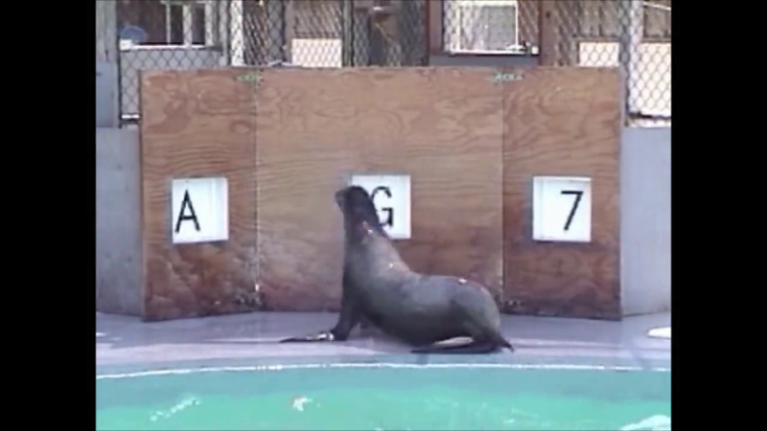
Shared outcomes organize learned stimulus classes
A functional stimulus class contains different stimuli that acquire a shared behavioral role. Reichmuth Kastak and colleagues presented two sea lions with 20 visual patterns divided into two sets of 10. In simple discrimination sessions, one set produced correct choices and the other produced incorrect choices; reversing the assignment changed which set was rewarded.
Sessions contained 40 trials in four blocks of 10, with stimulus positions balanced between left and right. The animals acquired classes through repeated reversals, then transferred the class relationships to matching-to-sample. In that task, the sample determined which comparison belonged to the appropriate learned class.
Correct responses to the different classes produced class-specific fish reinforcers. Subsequent experiments related new patterns to established classes through these outcomes. Learning linked visual cues and expected consequences, allowing a nose-touch choice to depend on prior reinforcement relationships rather than physical resemblance alone.
Reichmuth Kastak et al. (2001), Fig. 1. Rio performs simple and conditional visual discriminations.
Cook et al. (2021), Video 17.3 excerpt. Rio chooses within a learned stimulus class.
Reichmuth Kastak et al. (2001)
30
Notes:
• A **functional stimulus class** contains different stimuli that acquire a shared behavioral role. Reichmuth Kastak and colleagues presented two sea lions with 20 visual patterns divided into two sets of 10. In simple discrimination sessions, one set produced correct choices and the other produced incorrect choices; reversing the assignment changed which set was rewarded.
• Sessions contained 40 trials in four blocks of 10, with stimulus positions balanced between left and right. The animals acquired classes through repeated reversals, then transferred the class relationships to matching-to-sample. In that task, the sample determined which comparison belonged to the appropriate learned class.
• Correct responses to the different classes produced class-specific fish reinforcers. Subsequent experiments related new patterns to established classes through these outcomes. Learning linked visual cues and expected consequences, allowing a nose-touch choice to depend on prior reinforcement relationships rather than physical resemblance alone.
References:
Reichmuth Kastak C, Schusterman RJ, Kastak D (2001). Equivalence classification by California sea lions using class-specific reinforcers. Journal of the Experimental Analysis of Behavior 76(2):131–158. https://doi.org/10.1901/jeab.2001.76-131
Cook PF, Reichmuth C, Hanke FD (2021). The Mind of a Sea Lion. In: The Brain of the Marine Mammal. https://doi.org/10.1007/978-3-030-59184-7_17. Supplementary recordings 17.1–17.3 accompany this chapter and depict the trained procedures, not necessarily the specific published test trials.
Figure: Reichmuth Kastak et al. (2001), Fig. 1. Rio performs simple and conditional visual discriminations.
Figure source: https://doi.org/10.1901/jeab.2001.76-131
Embedded recording: Cook et al. (2021), Video 17.3 excerpt. Rio chooses within a learned stimulus class.
Source URL: https://e.video-cdn.net/watch?video-id=Dk7Vni8uNuSe-GwX6DwYjE&player-id=-qZL2aSgACrhe2fEUstC_v&channel-id=86512
Article DOI: https://doi.org/10.1007/978-3-030-59184-7_17
Credit: Cook, Reichmuth, and Hanke. License: No open license stated.
Discuss the displayed behavior and compare it with the adjacent published measurements. Original timing and audio retained; poster is an unedited frame. The embedded MP4 preserves native display proportions, original timing, scene order, and audio; compatibility conversion details are recorded in media_conversion_audit.json when applicable. Desktop PowerPoint playback and Google Slides import were not tested.
Instructor-authorized excerpt: 210 to 245 seconds. H264 CRF26; AAC96kbps; no speed change; original frame rate and audio timing retained; final delivery H264 CRF30, proportional width capped at 1280 px, no frame-rate or speed change. Spatial crop: None. This excerpt retains the source behavior and sound sequence; omitted sections are outside the selected task.
The chapter supplement records the trained task. It is not identified as a trial from the earlier article; numerical findings refer to that cited article.

Slide 31
The same correction transfers to other base rates
The main perturbation series used 85 bpm. Researchers also tested two additional unfamiliar baseline rates, approximately 77.3 and 94.4 bpm, with phase and tempo disturbances. This extended the correction test beyond a single preferred starting rhythm.
Ronan adapted across the additional baseline conditions as well. The ability to correct an ongoing response therefore generalized both across disturbance types and across the initial rate from which the disturbance was introduced.
A timing mechanism that operates across these conditions must use the relationship between the current sound interval and the current movement cycle. A correction learned only for a particular sound timestamp or one fixed movement rate would not provide the same flexibility across different baseline rhythms.
Rouse et al. (2016), Fig. 1. Controlled timing perturbations around a baseline rhythm.
Rouse et al. (2016)
31
Notes:
• The main perturbation series used 85 bpm. Researchers also tested two additional unfamiliar baseline rates, approximately 77.3 and 94.4 bpm, with phase and tempo disturbances. This extended the correction test beyond a single preferred starting rhythm.
• Ronan adapted across the additional baseline conditions as well. The ability to correct an ongoing response therefore generalized both across disturbance types and across the initial rate from which the disturbance was introduced.
• A timing mechanism that operates across these conditions must use the relationship between the current sound interval and the current movement cycle. A correction learned only for a particular sound timestamp or one fixed movement rate would not provide the same flexibility across different baseline rhythms.
References:
Rouse AA, Cook PF, Large EW, Reichmuth C (2016). Beat Keeping in a Sea Lion As Coupled Oscillation: Implications for Comparative Understanding of Human Rhythm. Frontiers in Neuroscience 10:257. https://doi.org/10.3389/fnins.2016.00257
Figure: Rouse et al. (2016), Fig. 1. Controlled timing perturbations around a baseline rhythm.
Figure source: https://doi.org/10.3389/fnins.2016.00257

Slide 32
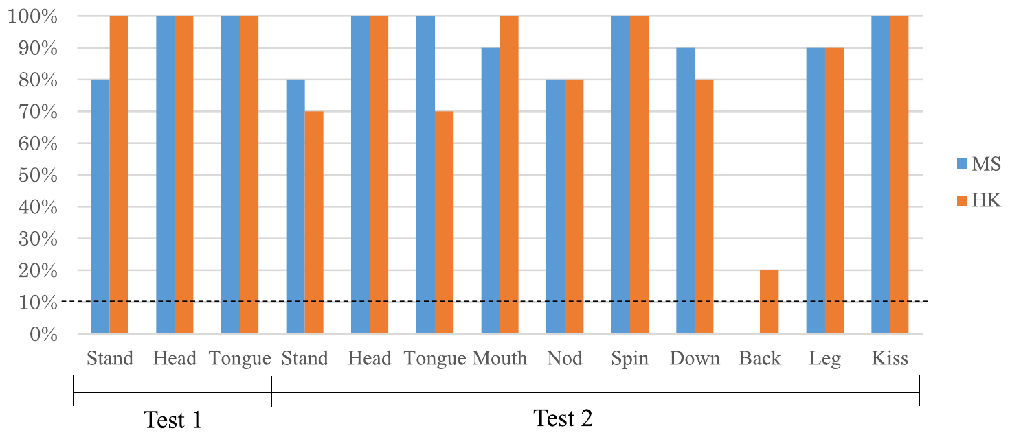
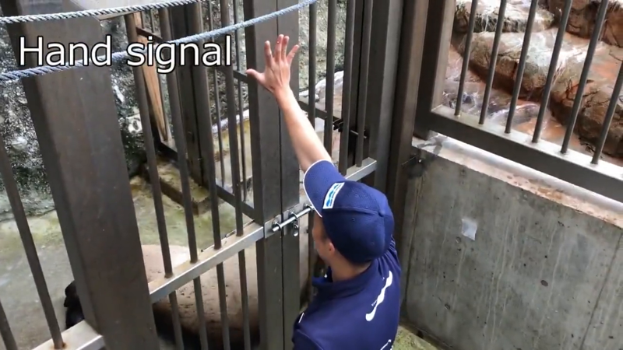
Hama matches human actions beyond specific commands
Hama, a Steller sea lion, had already learned a repertoire of actions through hand signals and verbal commands. Sasaki and colleagues trained a do-as-I-do response, in which a human action becomes the model for the animal’s action. Demonstrating “stand,” a head movement, or a tongue action replaced the usual specific cue.
The human initially paired demonstrations with familiar cues, then reduced those prompts. Hama subsequently matched most tested body actions with both a familiar trainer and an unfamiliar demonstrator. Several actions were familiar to her but had not been taught through the demonstration procedure.
Transfer separated general action matching from simply repeating the three demonstrations used during initial training. Performance also depended on what kind of action was attempted: novel body-oriented responses were easier than novel object manipulations. The acquired relationship linked observed body movement with selection from Hama’s own action repertoire.
Sasaki et al. (2025), Fig. 2. Action matching with familiar and unfamiliar human demonstrators.
Sasaki et al. (2025), learned-command recording excerpt. Hama responds to familiar vocal and hand cues.
Sasaki et al. (2025)
32
Notes:
• Hama, a Steller sea lion, had already learned a repertoire of actions through hand signals and verbal commands. Sasaki and colleagues trained a **do-as-I-do** response, in which a human action becomes the model for the animal’s action. Demonstrating “stand,” a head movement, or a tongue action replaced the usual specific cue.
• The human initially paired demonstrations with familiar cues, then reduced those prompts. Hama subsequently matched most tested body actions with both a familiar trainer and an unfamiliar demonstrator. Several actions were familiar to her but had not been taught through the demonstration procedure.
• Transfer separated general action matching from simply repeating the three demonstrations used during initial training. Performance also depended on what kind of action was attempted: novel body-oriented responses were easier than novel object manipulations. The acquired relationship linked observed body movement with selection from Hama’s own action repertoire.
References:
Sasaki M, Kinoshita H, Konno A (2025). Do as I do imitation in a steller sea lion Eumetopias jubatus. Animal Cognition 28:49. https://doi.org/10.1007/s10071-025-01971-0
Figure: Sasaki et al. (2025), Fig. 2. Action matching with familiar and unfamiliar human demonstrators.
Figure source: https://doi.org/10.1007/s10071-025-01971-0
Embedded recording: Sasaki et al. (2025), learned-command recording excerpt. Hama responds to familiar vocal and hand cues.
Source URL: https://www.youtube.com/watch?v=-Kwv_fMeG5w
Article DOI: https://doi.org/10.1007/s10071-025-01971-0
Credit: Sasaki, Kinoshita, and Konno. License: No open license stated; instructor-provided study recording.
Discuss the displayed behavior and compare it with the adjacent published measurements. Original timing and audio retained; poster is an unedited frame. The embedded MP4 preserves native display proportions, original timing, scene order, and audio; compatibility conversion details are recorded in media_conversion_audit.json when applicable. Desktop PowerPoint playback and Google Slides import were not tested.
Instructor-authorized excerpt: 4 to 27 seconds. H264 CRF26; AAC96kbps; no speed change; original frame rate and audio timing retained; final delivery H264 CRF30, proportional width capped at 1280 px, no frame-rate or speed change. Spatial crop: None. This excerpt retains the source behavior and sound sequence; omitted sections are outside the selected task.
This recording contains familiar command responses, not the delayed-Go imitation test.

Slide 33
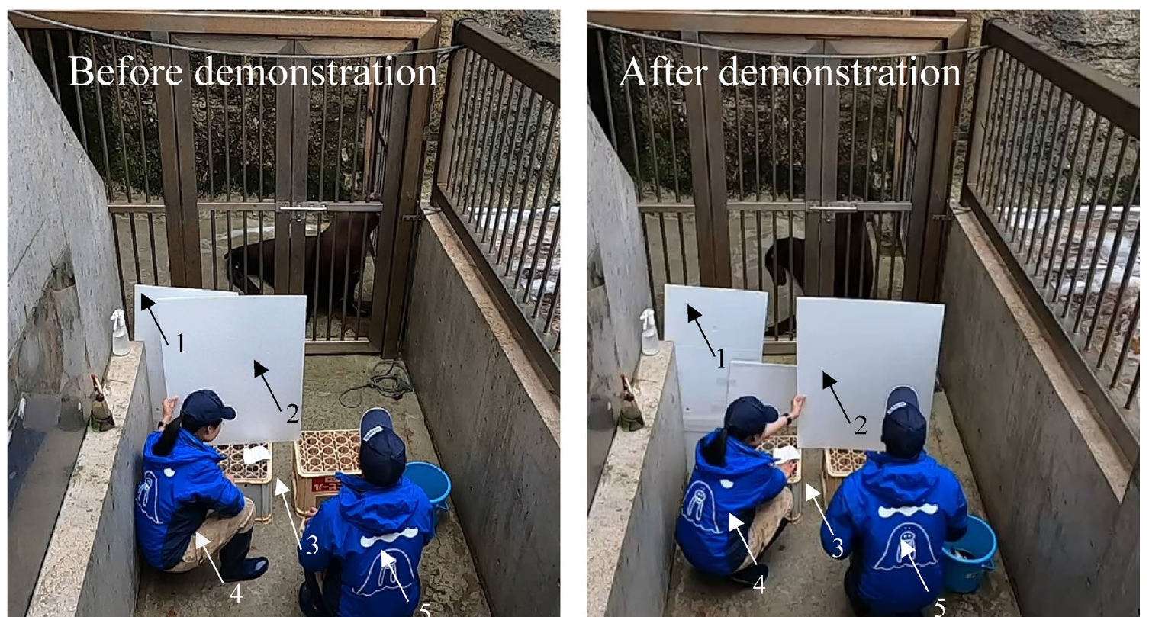
A Go cue separates remembering from immediate copying
In a second procedure, Hama watched a complete human demonstration while remaining still, then acted upon the verbal cue “Go.” Response inhibition is withholding an action that would otherwise occur. Learning to wait changed her earlier history of moving simultaneously with human demonstrations.
The tests included standing, spinning, lifting a hindflipper, and a kissing action. In a control condition, a barrier blocked visual contact with the demonstrator after the demonstration. Hama still produced the corresponding action when the demonstrator delivered the Go cue.
The final cue therefore specified when to respond, while the preceding demonstration specified what to do. Blocking the demonstrator during the response removed ongoing visual guidance as a requirement. This delayed command procedure differs from beat synchronization, where repeated sound events continually regulate the timing of an ongoing movement.
Sasaki et al. (2025), Fig. 5. Visual barriers used after the human demonstration.
Sasaki et al. (2025)
33
Notes:
• In a second procedure, Hama watched a complete human demonstration while remaining still, then acted upon the verbal cue “Go.” **Response inhibition** is withholding an action that would otherwise occur. Learning to wait changed her earlier history of moving simultaneously with human demonstrations.
• The tests included standing, spinning, lifting a hindflipper, and a kissing action. In a control condition, a barrier blocked visual contact with the demonstrator after the demonstration. Hama still produced the corresponding action when the demonstrator delivered the Go cue.
• The final cue therefore specified when to respond, while the preceding demonstration specified what to do. Blocking the demonstrator during the response removed ongoing visual guidance as a requirement. This delayed command procedure differs from beat synchronization, where repeated sound events continually regulate the timing of an ongoing movement.
References:
Sasaki M, Kinoshita H, Konno A (2025). Do as I do imitation in a steller sea lion Eumetopias jubatus. Animal Cognition 28:49. https://doi.org/10.1007/s10071-025-01971-0
Figure: Sasaki et al. (2025), Fig. 5. Visual barriers used after the human demonstration.
Figure source: https://doi.org/10.1007/s10071-025-01971-0

Slide 34
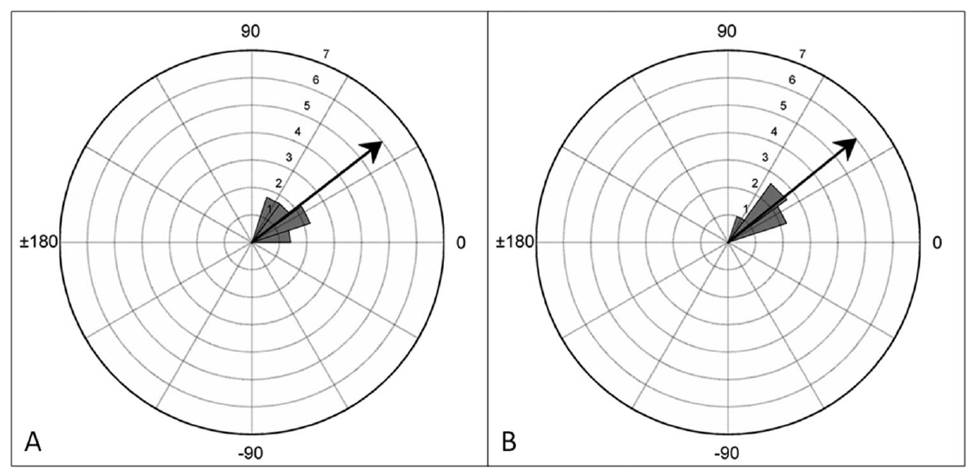
Missing beats distinguish prediction from isolated reactions
A reaction to each sound separately need not maintain a rhythm through silence. Cook and colleagues therefore omitted occasional beats from a 120 bpm sequence. Discrete clicks replaced the continuously modulated sound so that the missing event left a genuinely silent interval.
Ronan continued bobbing through the omitted events. Movements before and after the gap retained similar relationships to the expected beat locations. The repeating action continued while the next timing sound was absent instead of restarting only when another click arrived.
Continuation through an omission supports an ongoing timing process beyond isolated sound-triggered reactions. Later sounds can correct the position of the movement within the cycle. This combination of continuation and correction connects predictive timing with the perturbation experiments that independently changed beat position and tempo.
Cook et al. (2013), Fig. 3A–B. Timing before and after omitted clicks.
Cook et al. (2013)
34
Notes:
• A reaction to each sound separately need not maintain a rhythm through silence. Cook and colleagues therefore omitted occasional beats from a 120 bpm sequence. Discrete clicks replaced the continuously modulated sound so that the missing event left a genuinely silent interval.
• Ronan continued bobbing through the omitted events. Movements before and after the gap retained similar relationships to the expected beat locations. The repeating action continued while the next timing sound was absent instead of restarting only when another click arrived.
• Continuation through an omission supports an ongoing timing process beyond isolated sound-triggered reactions. Later sounds can correct the position of the movement within the cycle. This combination of continuation and correction connects predictive timing with the perturbation experiments that independently changed beat position and tempo.
References:
Cook PF, Rouse A, Wilson M, Reichmuth C (2013). A California sea lion (Zalophus californianus) can keep the beat: Motor entrainment to rhythmic auditory stimuli in a non vocal mimic. Journal of Comparative Psychology 127(4): 412–427. https://doi.org/10.1037/a0032345
Figure: Cook et al. (2013), Fig. 3A–B. Timing before and after omitted clicks.
Figure source: https://doi.org/10.1037/a0032345

Slide 35
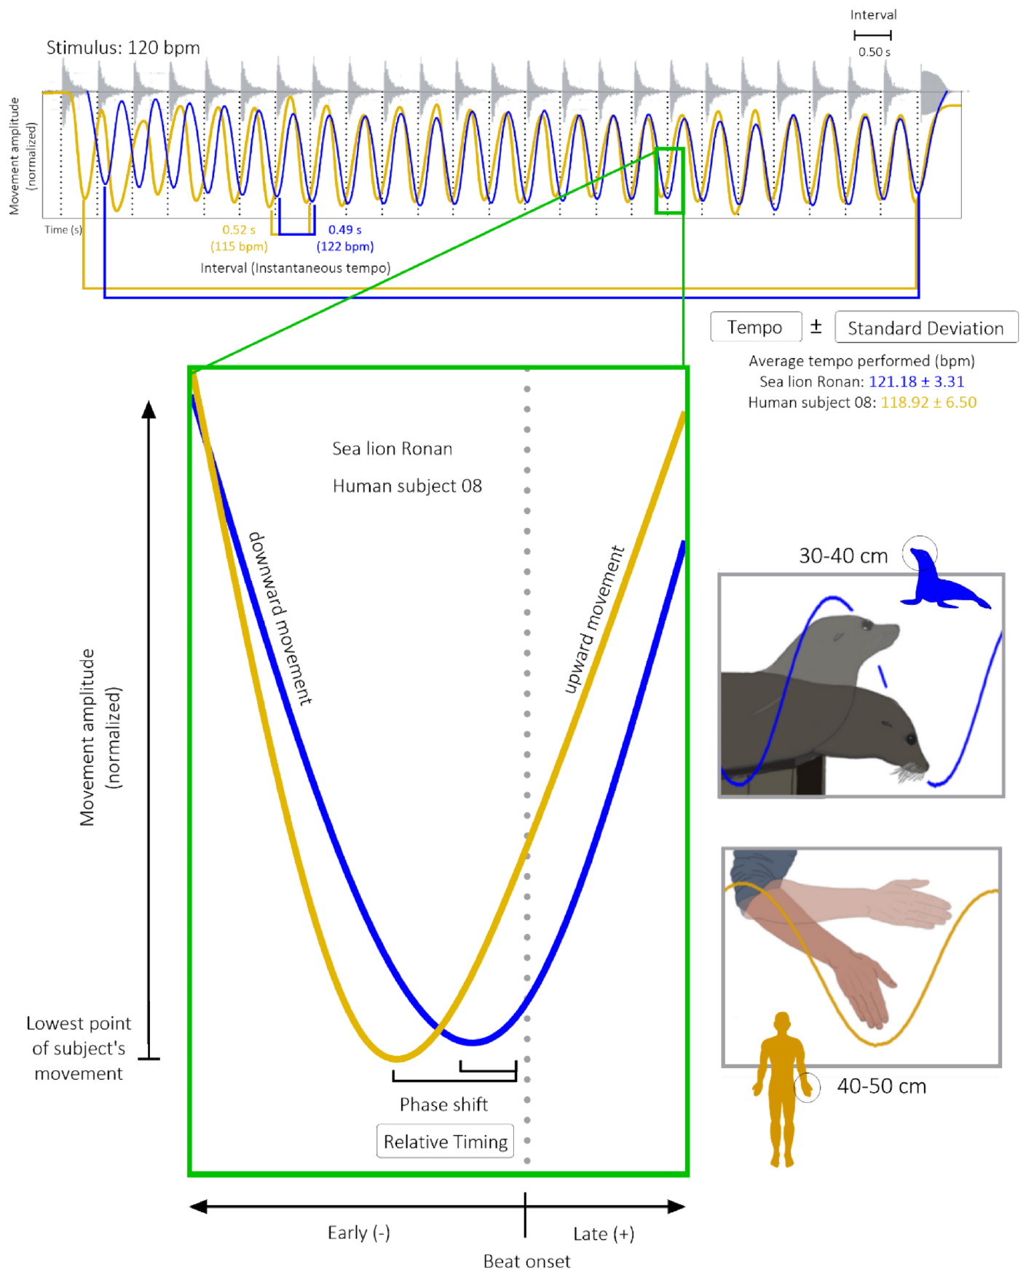
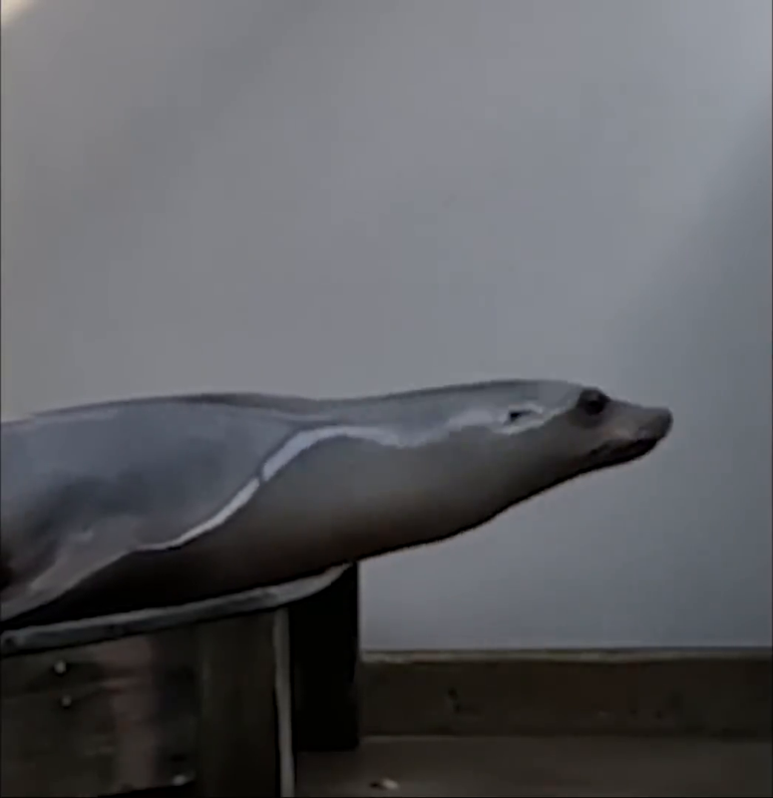
Sound onsets and movement minima share a time base
A continuous head movement needs a defined event for comparison with a sound onset. Ronan’s selected landmark was the lowest point of each head bob. In the human comparison, it was the fullest downward extension of the arm. Using a repeatable landmark keeps the measured timing event consistent.
The interval between successive movement minima supplies the performed tempo. The position of each minimum relative to a sound onset supplies phase. Automated video tracking measured the trajectories while the audio track from the same recording identified sound events.
The 2025 experiment recorded at 240 frames per second, corresponding to roughly 4 ms between frames. This resolution allowed small anticipatory and delayed offsets to be measured within a cycle. A movement rate near the target can coexist with a nonzero offset from each sound, so both quantities characterize the coordination.
Cook et al. (2025), Fig. 1. Movement trajectories aligned with recorded sound onsets.
Cook et al. (2025), ESM 2 excerpt. Ronan’s first exposure to 112 bpm snare beats.
Cook et al. (2025)
35
Notes:
• A continuous head movement needs a defined event for comparison with a sound onset. Ronan’s selected landmark was the lowest point of each head bob. In the human comparison, it was the fullest downward extension of the arm. Using a repeatable landmark keeps the measured timing event consistent.
• The interval between successive movement minima supplies the performed tempo. The position of each minimum relative to a sound onset supplies phase. Automated video tracking measured the trajectories while the audio track from the same recording identified sound events.
• The 2025 experiment recorded at 240 frames per second, corresponding to roughly 4 ms between frames. This resolution allowed small anticipatory and delayed offsets to be measured within a cycle. A movement rate near the target can coexist with a nonzero offset from each sound, so both quantities characterize the coordination.
References:
Cook PF, Hood C, Rouse A, Reichmuth C (2025). Sensorimotor synchronization to rhythm in an experienced sea lion rivals that of humans. Scientific Reports 15:12125. https://doi.org/10.1038/s41598-025-95279-1
Figure: Cook et al. (2025), Fig. 1. Movement trajectories aligned with recorded sound onsets.
Figure source: https://doi.org/10.1038/s41598-025-95279-1
Embedded recording: Cook et al. (2025), ESM 2 excerpt. Ronan’s first exposure to 112 bpm snare beats.
Source URL: https://www.youtube.com/watch?v=1zZc18B8ZW0
Article DOI: https://doi.org/10.1038/s41598-025-95279-1
Credit: Cook and colleagues. License: CC BY 4.0; original article supplementary recording.
Discuss the displayed behavior and compare it with the adjacent published measurements. Original timing and audio retained; poster is an unedited frame. The embedded MP4 preserves native display proportions, original timing, scene order, and audio; compatibility conversion details are recorded in media_conversion_audit.json when applicable. Desktop PowerPoint playback and Google Slides import were not tested.
Instructor-authorized excerpt: 18 to 30 seconds. H264 CRF26; AAC96kbps; no speed change; original frame rate and audio timing retained; final delivery H264 CRF30, proportional width capped at 1280 px, no frame-rate or speed change. Spatial crop: crop=1046:1080:430:0. This excerpt retains the source behavior and sound sequence; omitted sections are outside the selected task.

Slide 36
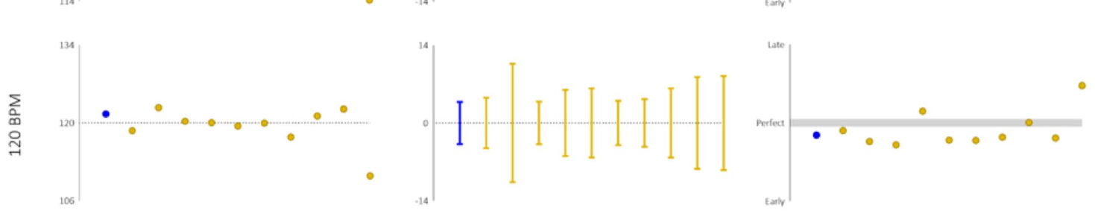
Precise timing can include an anticipatory offset
A negative asynchrony occurs when the selected movement landmark precedes the sound. In Ronan’s 2025 snare tests, the average phase at 112 and 120 bpm was negative, while the average at 128 bpm was slightly positive.
This timing pattern is inconsistent with treating every head bob as a delayed reaction initiated only after each sound occurs. A repeating movement can be scheduled in anticipation of the next event while continuing to receive timing information from the current acoustic sequence.
At the same time, anticipation need not place every movement exactly at zero phase. Coordination can be stable and predictive with a systematic offset. Describing the signed relationship preserves that biological timing pattern instead of reducing the response to a simple success-versus-failure label.
Cook et al. (2025), Fig. 3, 120 bpm row. Timing with the familiar-rate snare sequence.
Cook et al. (2025)
36
Notes:
• A **negative asynchrony** occurs when the selected movement landmark precedes the sound. In Ronan’s 2025 snare tests, the average phase at 112 and 120 bpm was negative, while the average at 128 bpm was slightly positive.
• This timing pattern is inconsistent with treating every head bob as a delayed reaction initiated only after each sound occurs. A repeating movement can be scheduled in anticipation of the next event while continuing to receive timing information from the current acoustic sequence.
• At the same time, anticipation need not place every movement exactly at zero phase. Coordination can be stable and predictive with a systematic offset. Describing the signed relationship preserves that biological timing pattern instead of reducing the response to a simple success-versus-failure label.
References:
Cook PF, Hood C, Rouse A, Reichmuth C (2025). Sensorimotor synchronization to rhythm in an experienced sea lion rivals that of humans. Scientific Reports 15:12125. https://doi.org/10.1038/s41598-025-95279-1
Figure: Cook et al. (2025), Fig. 3, 120 bpm row. Timing with the familiar-rate snare sequence.
Figure source: https://doi.org/10.1038/s41598-025-95279-1

Slide 37
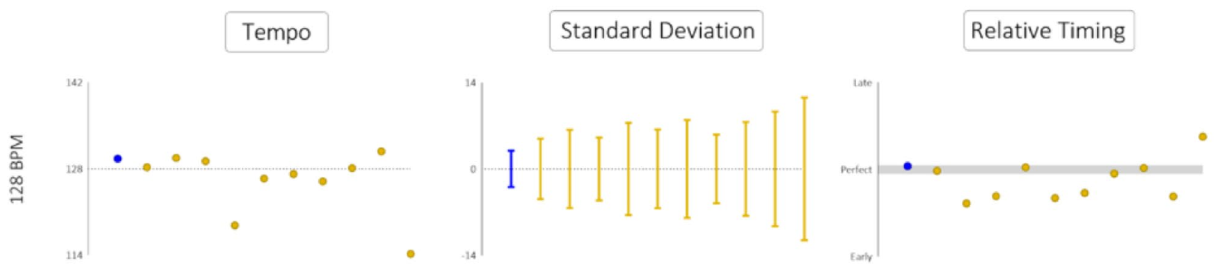
Rate accuracy and response consistency differ
The human comparison separately evaluated performed tempo, variability of movement intervals, and timing relative to sound onset. These dimensions answer different behavioral questions: how fast the repeated action runs, how consistently it repeats, and where it falls within the external cycle.
Ronan’s intervals were more consistent than those of the human participants across the three test rates. Her average tempo or average phase was also closer to the target than that of many participants, but the relative ranking depended on the performance measure.
No human exceeded Ronan on all measured dimensions. The conclusion rests on matched-task performance rather than a claim that the animal is superior at every possible rhythmic activity. Gross movement, stimulus form, and the selected timing landmark define the behavior that was compared.
Cook et al. (2025), Fig. 3, 128 bpm row. Different dimensions of synchronized performance.
Cook et al. (2025)
37
Notes:
• The human comparison separately evaluated performed tempo, variability of movement intervals, and timing relative to sound onset. These dimensions answer different behavioral questions: how fast the repeated action runs, how consistently it repeats, and where it falls within the external cycle.
• Ronan’s intervals were more consistent than those of the human participants across the three test rates. Her average tempo or average phase was also closer to the target than that of many participants, but the relative ranking depended on the performance measure.
• No human exceeded Ronan on all measured dimensions. The conclusion rests on matched-task performance rather than a claim that the animal is superior at every possible rhythmic activity. Gross movement, stimulus form, and the selected timing landmark define the behavior that was compared.
References:
Cook PF, Hood C, Rouse A, Reichmuth C (2025). Sensorimotor synchronization to rhythm in an experienced sea lion rivals that of humans. Scientific Reports 15:12125. https://doi.org/10.1038/s41598-025-95279-1
Figure: Cook et al. (2025), Fig. 3, 128 bpm row. Different dimensions of synchronized performance.
Figure source: https://doi.org/10.1038/s41598-025-95279-1

Slide 38
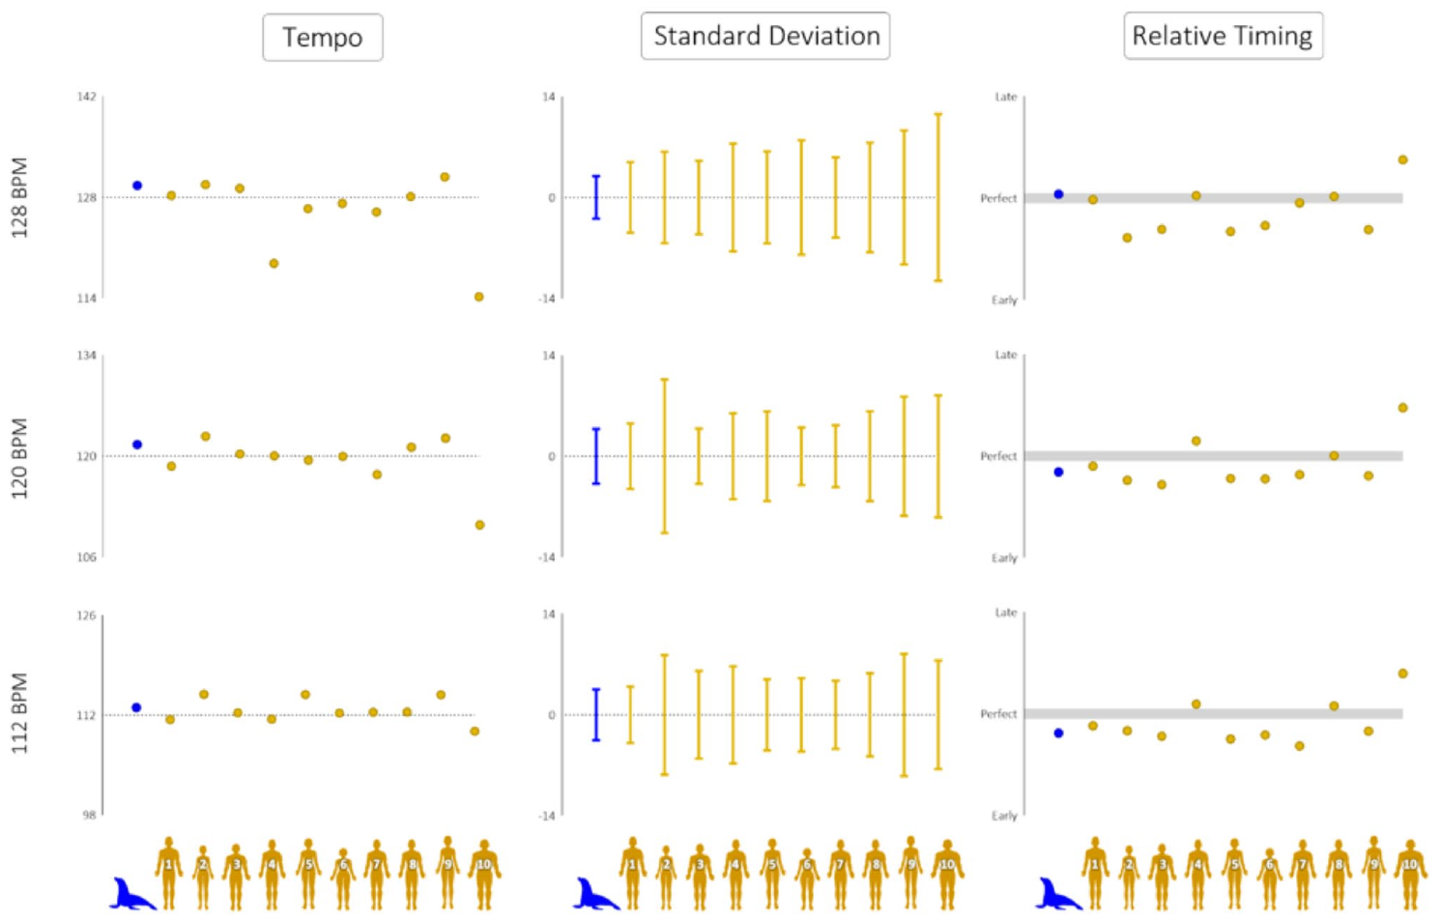
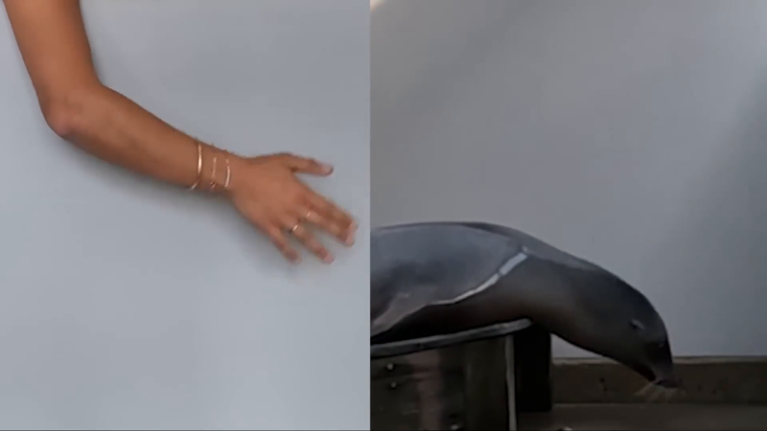
Human gross movements vary across individuals
Humans in the comparison were non-musicians performing a large arm movement rather than a familiar tapping task. Their synchronization differed among individuals, with some participants producing less consistent movement intervals and more variable phases than others.
The distribution of performance matters because a comparison with only a hypothetical perfectly regular human would conceal the range of actual behavior. The experiment measured the same sound sequences in both species and retained each participant’s timing profile.
The study found no consistent rapid improvement across the brief human testing sequence. Ronan, in contrast, entered with a long history of the head-bob task. The observed comparison therefore describes an experienced sea lion and humans performing the specified large-amplitude coordination task, with their different task histories made explicit.
Cook et al. (2025), Fig. 3. Individual human and sea-lion timing measures.
Cook et al. (2025), ESM 2 excerpt. Matched sea-lion head and human arm movements.
Cook et al. (2025)
38
Notes:
• Humans in the comparison were non-musicians performing a large arm movement rather than a familiar tapping task. Their synchronization differed among individuals, with some participants producing less consistent movement intervals and more variable phases than others.
• The distribution of performance matters because a comparison with only a hypothetical perfectly regular human would conceal the range of actual behavior. The experiment measured the same sound sequences in both species and retained each participant’s timing profile.
• The study found no consistent rapid improvement across the brief human testing sequence. Ronan, in contrast, entered with a long history of the head-bob task. The observed comparison therefore describes an experienced sea lion and humans performing the specified large-amplitude coordination task, with their different task histories made explicit.
References:
Cook PF, Hood C, Rouse A, Reichmuth C (2025). Sensorimotor synchronization to rhythm in an experienced sea lion rivals that of humans. Scientific Reports 15:12125. https://doi.org/10.1038/s41598-025-95279-1
Figure: Cook et al. (2025), Fig. 3. Individual human and sea-lion timing measures.
Figure source: https://doi.org/10.1038/s41598-025-95279-1
Embedded recording: Cook et al. (2025), ESM 2 excerpt. Matched sea-lion head and human arm movements.
Source URL: https://www.youtube.com/watch?v=1zZc18B8ZW0
Article DOI: https://doi.org/10.1038/s41598-025-95279-1
Credit: Cook and colleagues. License: CC BY 4.0; original article supplementary recording.
Discuss the displayed behavior and compare it with the adjacent published measurements. Original timing and audio retained; poster is an unedited frame. The embedded MP4 preserves native display proportions, original timing, scene order, and audio; compatibility conversion details are recorded in media_conversion_audit.json when applicable. Desktop PowerPoint playback and Google Slides import were not tested.
Instructor-authorized excerpt: 38 to 50 seconds. H264 CRF26; AAC96kbps; no speed change; original frame rate and audio timing retained; final delivery H264 CRF30, proportional width capped at 1280 px, no frame-rate or speed change. Spatial crop: None. This excerpt retains the source behavior and sound sequence; omitted sections are outside the selected task.

Slide 39
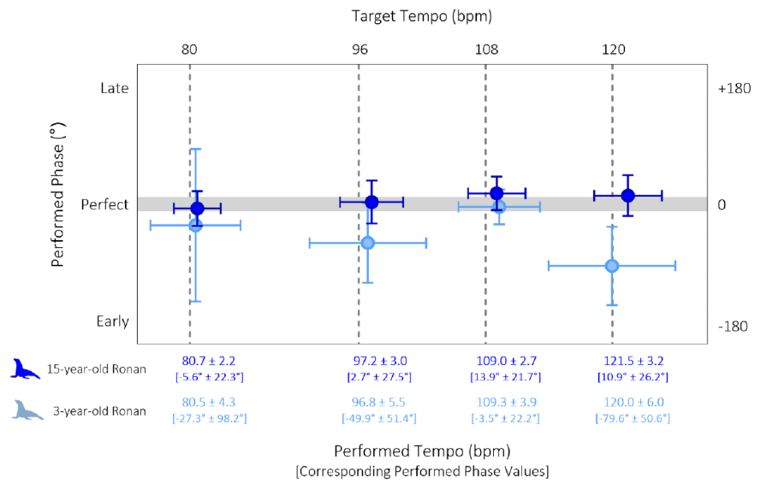
Long-term performance includes improved phase alignment
At the familiar simple-stimulus rates, Ronan’s later phase alignment was much closer to zero than in several early conditions. The large negative offsets recorded at slower rates in 2013 were substantially reduced when those stimuli were retested after longitudinal experience.
Improvement involved more than bringing the average movement rate near the stimulus. The timing landmark moved closer to the sound onset, and successive movements became more consistent. Rate, phase, and consistency therefore changed together in the later performance profile.
The 108 bpm condition already had a phase near zero in the early experiment, leaving less room for improvement on that particular measure. This condition-specific pattern connects the long-term result to the actual starting performance rather than assuming identical improvement at every tested rate.
Cook et al. (2025), Fig. 2. Reduced timing offsets in experienced performance.
Cook et al. (2025)
39
Notes:
• At the familiar simple-stimulus rates, Ronan’s later phase alignment was much closer to zero than in several early conditions. The large negative offsets recorded at slower rates in 2013 were substantially reduced when those stimuli were retested after longitudinal experience.
• Improvement involved more than bringing the average movement rate near the stimulus. The timing landmark moved closer to the sound onset, and successive movements became more consistent. Rate, phase, and consistency therefore changed together in the later performance profile.
• The 108 bpm condition already had a phase near zero in the early experiment, leaving less room for improvement on that particular measure. This condition-specific pattern connects the long-term result to the actual starting performance rather than assuming identical improvement at every tested rate.
References:
Cook PF, Hood C, Rouse A, Reichmuth C (2025). Sensorimotor synchronization to rhythm in an experienced sea lion rivals that of humans. Scientific Reports 15:12125. https://doi.org/10.1038/s41598-025-95279-1
Figure: Cook et al. (2025), Fig. 2. Reduced timing offsets in experienced performance.
Figure source: https://doi.org/10.1038/s41598-025-95279-1

Slide 40
The tested skill is flexible beat synchronization
Ronan’s experiments established coordination with regular pulse sequences and with musical recordings that contain a regular pulse. Beat synchronization is the alignment of a repeated action with those pulse events, with flexibility across rates and acoustic forms.
More complex musical abilities involve additional structure, such as grouping beats into recurring patterns or coordinating with deliberately irregular sequences. The 2025 paper distinguished the measured beat-keeping skill from these broader questions about musical organization.
That distinction changes the scientific interpretation: flexible auditory–motor timing is experimentally supported in this sea lion, while complete human-like musical competence was not the tested outcome. The behavioral result still provides a substantial comparative example of prediction, repeated movement, transfer, and adjustment to external rhythm.
Cook et al. (2025), Fig. 1. Shared movement and timing definitions.
Cook et al. (2025)
40
Notes:
• Ronan’s experiments established coordination with regular pulse sequences and with musical recordings that contain a regular pulse. **Beat synchronization** is the alignment of a repeated action with those pulse events, with flexibility across rates and acoustic forms.
• More complex musical abilities involve additional structure, such as grouping beats into recurring patterns or coordinating with deliberately irregular sequences. The 2025 paper distinguished the measured beat-keeping skill from these broader questions about musical organization.
• That distinction changes the scientific interpretation: flexible auditory–motor timing is experimentally supported in this sea lion, while complete human-like musical competence was not the tested outcome. The behavioral result still provides a substantial comparative example of prediction, repeated movement, transfer, and adjustment to external rhythm.
References:
Cook PF, Hood C, Rouse A, Reichmuth C (2025). Sensorimotor synchronization to rhythm in an experienced sea lion rivals that of humans. Scientific Reports 15:12125. https://doi.org/10.1038/s41598-025-95279-1
Figure: Cook et al. (2025), Fig. 1. Shared movement and timing definitions.
Figure source: https://doi.org/10.1038/s41598-025-95279-1

Slide 41
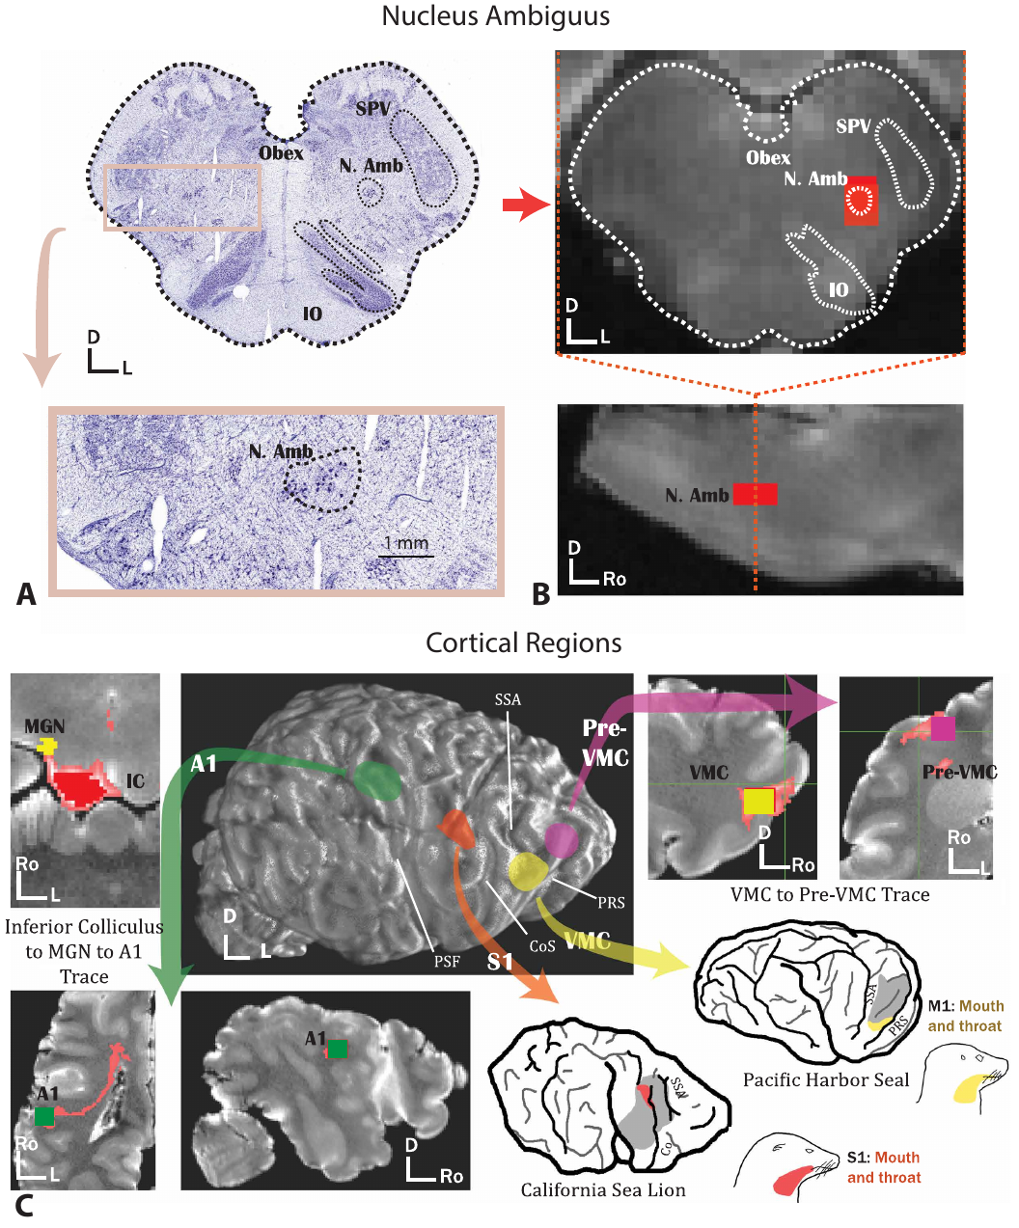
Histology anchors vocal pathways in the sea-lion brain
Cook and colleagues combined tissue staining with diffusion magnetic resonance imaging, which measures direction-dependent water movement in preserved brain tissue. Ex vivo means outside the living animal. Histology located the nucleus ambiguus, a brainstem nucleus associated with control of muscles used in breathing, swallowing, and vocalization.
The stained sections were aligned with structural MRI using anatomical landmarks. Researchers marked the corresponding voxels, the three-dimensional sampling units of the scan. Cortical regions included primary auditory cortex, vocal motor cortex, and the neighboring vocal premotor region, which is associated with preparation of vocal actions.
Probabilistic tractography estimates possible fiber trajectories from diffusion measurements. The researchers traced pathways in both hemispheres and compared California sea lions, elephant seals, harbor seals, and coyotes. Combining microscopic identification with MRI constrained where each trace began and which anatomical regions a proposed route had to traverse.
Cook et al. (2026), Fig. 1A–C. Histological and MRI localization of brainstem and cortical regions.
Cook et al. (2026)
41
Notes:
• Cook and colleagues combined tissue staining with **diffusion magnetic resonance imaging**, which measures direction-dependent water movement in preserved brain tissue. **Ex vivo** means outside the living animal. Histology located the **nucleus ambiguus**, a brainstem nucleus associated with control of muscles used in breathing, swallowing, and vocalization.
• The stained sections were aligned with structural MRI using anatomical landmarks. Researchers marked the corresponding **voxels**, the three-dimensional sampling units of the scan. Cortical regions included primary auditory cortex, vocal motor cortex, and the neighboring vocal premotor region, which is associated with preparation of vocal actions.
• **Probabilistic tractography** estimates possible fiber trajectories from diffusion measurements. The researchers traced pathways in both hemispheres and compared California sea lions, elephant seals, harbor seals, and coyotes. Combining microscopic identification with MRI constrained where each trace began and which anatomical regions a proposed route had to traverse.
References:
Cook PF, Rouse AA, Sawyer E, Miller K, Berns G (2026). Seal and sea lion brains have evolved to support volitional control of vocal behavior and learning. Science 391(6790):1146–1150. https://doi.org/10.1126/science.adx9367
Figure: Cook et al. (2026), Fig. 1A–C. Histological and MRI localization of brainstem and cortical regions.
Figure source: https://doi.org/10.1126/science.adx9367

Slide 42


Vocal motor pathways reach the phonatory brainstem
All examined pinniped species had robust bilateral tractography connections between putative vocal motor cortex and nucleus ambiguus. Corresponding pathways were absent in the examined coyotes. Whole-brainstem and corticospinal control traces were comparable across species, separating the vocal-pathway difference from a general failure to reconstruct coyote fibers.
The vocal pathway was reconstructed while excluding the periaqueductal gray, a midbrain region involved in vocal control. This identified a route that could bypass that intervening region. Tractography estimates macroscopic pathways; its voxels cannot resolve whether the route contains a single synaptic connection.
The authors hypothesize that enhanced cortical access to phonatory brainstem circuits supports voluntary breathing and flexible use of existing calls. Submersion requires precise control over respiratory actions. Sea lions can learn when to produce or inhibit a species-typical call, linking this anatomical organization with contextual control of vocal behavior.
Cook et al. (2026), Fig. 2A. Reconstructed sea-lion cortical–brainstem pathway in two views.
Cook et al. (2026), Supplementary Movie S1. Reconstructed vocal motor cortex–brainstem pathways in a sea lion.
Cook et al. (2026)
42
Notes:
• All examined pinniped species had robust bilateral tractography connections between putative **vocal motor cortex** and nucleus ambiguus. Corresponding pathways were absent in the examined coyotes. Whole-brainstem and corticospinal control traces were comparable across species, separating the vocal-pathway difference from a general failure to reconstruct coyote fibers.
• The vocal pathway was reconstructed while excluding the **periaqueductal gray**, a midbrain region involved in vocal control. This identified a route that could bypass that intervening region. Tractography estimates macroscopic pathways; its voxels cannot resolve whether the route contains a single synaptic connection.
• The authors hypothesize that enhanced cortical access to phonatory brainstem circuits supports voluntary breathing and flexible use of existing calls. Submersion requires precise control over respiratory actions. Sea lions can learn when to produce or inhibit a species-typical call, linking this anatomical organization with contextual control of vocal behavior.
• The reconstructed routes concern vocal and respiratory control. The study did not record the neural circuitry generating Ronan’s head-bob synchronization.
References:
Cook PF, Rouse AA, Sawyer E, Miller K, Berns G (2026). Seal and sea lion brains have evolved to support volitional control of vocal behavior and learning. Science 391(6790):1146–1150. https://doi.org/10.1126/science.adx9367
Figure: Cook et al. (2026), Fig. 2A. Reconstructed sea-lion cortical–brainstem pathway in two views.
Figure source: https://doi.org/10.1126/science.adx9367
Embedded recording: Cook et al. (2026), Supplementary Movie S1. Reconstructed vocal motor cortex–brainstem pathways in a sea lion.
Source URL: https://www.science.org/doi/10.1126/science.adx9367#supplementary-materials
Article DOI: https://doi.org/10.1126/science.adx9367
Credit: Cook, Rouse, Sawyer, Miller, and Berns. License: Copyright 2026 authors; exclusive license AAAS; instructor-supplied original movie.
Discuss the displayed behavior and compare it with the adjacent published measurements. Original timing and audio retained; poster is an unedited frame. The embedded MP4 preserves native display proportions, original timing, scene order, and audio; compatibility conversion details are recorded in media_conversion_audit.json when applicable. Desktop PowerPoint playback and Google Slides import were not tested.

Slide 43

Voluntary calls and vocal imitation differ in circuitry
Vocal usage learning changes when an existing call is deployed. Vocal production learning changes the acoustic form of a call through experience. Sea lions exhibit flexible usage learning, whereas some true seals also learn new call forms or mimic sounds outside their usual repertoire.
Harbor seals had enhanced connectivity between the anterior ventrolateral thalamus and vocal premotor cortex. The study also traced pathways involving the striatum, a forebrain structure involved in action selection and reinforcement learning. The clearest forebrain difference involved the thalamic–premotor pathway, rather than uniformly stronger connectivity throughout every tested route.
Elephant and harbor seals additionally had robust auditory–premotor pathways that were not reconstructed robustly in sea lions. The authors hypothesize that these connections support developmental modification of calls using auditory input. Different combinations of pathways accompany different forms of vocal flexibility across closely related pinniped lineages.
Cook et al. (2026), Fig. 3D–F. Forebrain pathway strengths in coyotes, sea lions, and seals.
Cook et al. (2026)
43
Notes:
• **Vocal usage learning** changes when an existing call is deployed. **Vocal production learning** changes the acoustic form of a call through experience. Sea lions exhibit flexible usage learning, whereas some true seals also learn new call forms or mimic sounds outside their usual repertoire.
• Harbor seals had enhanced connectivity between the **anterior ventrolateral thalamus** and vocal premotor cortex. The study also traced pathways involving the **striatum**, a forebrain structure involved in action selection and reinforcement learning. The clearest forebrain difference involved the thalamic–premotor pathway, rather than uniformly stronger connectivity throughout every tested route.
• Elephant and harbor seals additionally had robust auditory–premotor pathways that were not reconstructed robustly in sea lions. The authors hypothesize that these connections support developmental modification of calls using auditory input. Different combinations of pathways accompany different forms of vocal flexibility across closely related pinniped lineages.
• The study compares anatomical connectivity with the behavioral literature. It did not train the scanned animals to acquire new vocalizations.
References:
Cook PF, Rouse AA, Sawyer E, Miller K, Berns G (2026). Seal and sea lion brains have evolved to support volitional control of vocal behavior and learning. Science 391(6790):1146–1150. https://doi.org/10.1126/science.adx9367
Figure: Cook et al. (2026), Fig. 3D–F. Forebrain pathway strengths in coyotes, sea lions, and seals.
Figure source: https://doi.org/10.1126/science.adx9367

Slide 44

Underwater hearing extends to sounds near 40 Hz
Sills and colleagues measured low-frequency underwater hearing in the California sea lion Ronan and bearded seals. The trained animals remained at a listening station and moved to a response target after detecting a sound. Signal-absent trials measured responses without a sound, while calibrated hydrophones measured the acoustic conditions.
An audiogram plots the sound level required for detection against frequency. Ronan detected a 40 Hz signal at a threshold of 121 dB re 1 µPa. This underwater pressure reference differs from the reference used for airborne hearing. Below 80 Hz, her threshold rose by only about 4 dB over the next octave.
At 40 Hz, the seals’ thresholds were 105 dB re 1 µPa, indicating greater sensitivity than Ronan at that frequency. Low-frequency detection therefore differed among pinnipeds even though all subjects detected the lowest tested frequency. The calibrated thresholds identify the sound levels available to guide behavior in an underwater environment.
Sills et al. (2025), Fig. 1a–b. Underwater hearing thresholds and background noise across frequencies.
Sills et al. (2025)
44
Notes:
• Sills and colleagues measured low-frequency underwater hearing in the California sea lion Ronan and bearded seals. The trained animals remained at a listening station and moved to a response target after detecting a sound. Signal-absent trials measured responses without a sound, while calibrated hydrophones measured the acoustic conditions.
• An **audiogram** plots the sound level required for detection against frequency. Ronan detected a 40 Hz signal at a threshold of 121 dB re 1 µPa. This underwater pressure reference differs from the reference used for airborne hearing. Below 80 Hz, her threshold rose by only about 4 dB over the next octave.
• At 40 Hz, the seals’ thresholds were 105 dB re 1 µPa, indicating greater sensitivity than Ronan at that frequency. Low-frequency detection therefore differed among pinnipeds even though all subjects detected the lowest tested frequency. The calibrated thresholds identify the sound levels available to guide behavior in an underwater environment.
References:
Sills JM, Ruscher B, Packard N, Jones RA, Southall BL, Reichmuth C (2025). Low-frequency hearing and masking parameters in representative seals and sea lions. Journal of the Acoustical Society of America 158(2):1585–1599. https://doi.org/10.1121/10.0039049
Figure: Sills et al. (2025), Fig. 1a–b. Underwater hearing thresholds and background noise across frequencies.
Figure source: https://doi.org/10.1121/10.0039049

Slide 45

Noise bandwidth changes low-frequency sound detection
Auditory masking occurs when background sound raises the level needed to detect a signal. A critical ratio is the difference between the masked detection threshold and the noise spectral density level. At 200 Hz, Ronan’s critical ratio was 18 dB, with a masked threshold of 101 dB re 1 µPa.
The researchers also narrowed the noise band around the signal while maintaining its spectral density. Ronan’s detection improved with one-third-octave and one-sixth-octave noise relative to octave-wide noise. Masking release is this improvement when a masker becomes less effective; with the narrowest band, her threshold approached the unmasked threshold.
The results place Ronan’s critical bandwidth, the frequency range over which noise effectively masks the signal, above one-third of an octave at 200 Hz. The bearded seals instead retained nearly unchanged thresholds at this frequency, indicating narrower critical bands. Signal frequency, noise level, and noise bandwidth jointly determine whether an underwater acoustic cue can be detected.
Sills et al. (2025), Fig. 3 (200, 100, 80, and 63 Hz panels). Detection improves as the masking noise band narrows.
Sills et al. (2025)
45
Notes:
• **Auditory masking** occurs when background sound raises the level needed to detect a signal. A **critical ratio** is the difference between the masked detection threshold and the noise spectral density level. At 200 Hz, Ronan’s critical ratio was 18 dB, with a masked threshold of 101 dB re 1 µPa.
• The researchers also narrowed the noise band around the signal while maintaining its spectral density. Ronan’s detection improved with one-third-octave and one-sixth-octave noise relative to octave-wide noise. **Masking release** is this improvement when a masker becomes less effective; with the narrowest band, her threshold approached the unmasked threshold.
• The results place Ronan’s **critical bandwidth**, the frequency range over which noise effectively masks the signal, above one-third of an octave at 200 Hz. The bearded seals instead retained nearly unchanged thresholds at this frequency, indicating narrower critical bands. Signal frequency, noise level, and noise bandwidth jointly determine whether an underwater acoustic cue can be detected.
References:
Sills JM, Ruscher B, Packard N, Jones RA, Southall BL, Reichmuth C (2025). Low-frequency hearing and masking parameters in representative seals and sea lions. Journal of the Acoustical Society of America 158(2):1585–1599. https://doi.org/10.1121/10.0039049
Figure: Sills et al. (2025), Fig. 3 (200, 100, 80, and 63 Hz panels). Detection improves as the masking noise band narrows.
Figure source: https://doi.org/10.1121/10.0039049

Slide 46
Key takeaways
Sensory organization Facial information enters trigeminal brainstem relays, a large medial thalamic subdivision, and a layer-4-rich somatosensory cortical region.
Active control Sea lions adjust whisker movements to the discrimination task, and reposition their flippers during turns and leaps.
Learned cues A command can initiate exploration or specify when to act; Hama retained a demonstrated action across a delayed Go cue and visual occlusion.
Tempo and phase A matching repetition rate and a stable relationship to individual beats are distinct aspects of synchronization.
Predictive correction Ronan continued through omitted beats and corrected ongoing movement after changes in beat position or tempo.
Experience and comparison An experienced sea lion performed precisely in a matched gross-movement task; rat recordings identify a separate candidate adaptation process.
Sawyer et al. (2016); Milne et al. (2021); Sasaki et al. (2025); Cook et al. (2013, 2025); Ito et al. (2022)
46
Notes:
Cook PF, Rouse A, Wilson M, Reichmuth C (2013). A California sea lion (Zalophus californianus) can keep the beat: Motor entrainment to rhythmic auditory stimuli in a non vocal mimic. Journal of Comparative Psychology 127(4): 412–427. https://doi.org/10.1037/a0032345
Rouse AA, Cook PF, Large EW, Reichmuth C (2016). Beat Keeping in a Sea Lion As Coupled Oscillation: Implications for Comparative Understanding of Human Rhythm. Frontiers in Neuroscience 10:257. https://doi.org/10.3389/fnins.2016.00257
Cook PF, Hood C, Rouse A, Reichmuth C (2025). Sensorimotor synchronization to rhythm in an experienced sea lion rivals that of humans. Scientific Reports 15:12125. https://doi.org/10.1038/s41598-025-95279-1
Ito Y, Shiramatsu TI, Ishida N, Oshima K, Magami K, Takahashi H (2022). Spontaneous beat synchronization in rats: Neural dynamics and motor entrainment. Science Advances 8:eabo7019. https://doi.org/10.1126/sciadv.abo7019
Sawyer EK, Turner EC, Kaas JH (2016). Somatosensory brainstem, thalamus, and cortex of the California sea lion (Zalophus californianus). Journal of Comparative Neurology 524(9):1957–1975. https://doi.org/10.1002/cne.23984
Milne AO, Grant RA (2014). Characterisation of whisker control in the California sea lion (Zalophus californianus) during a complex, dynamic sensorimotor task. Journal of Comparative Physiology A 200:871–879. https://doi.org/10.1007/s00359-014-0931-1
Milne AO, Orton L, Black CH, Jones GC, Sullivan M, Grant RA (2021). California sea lions employ task-specific strategies for active touch sensing. Journal of Experimental Biology 224(21):jeb243085. https://doi.org/10.1242/jeb.243085
Leahy AM, Fish FE, Kerr SJ, Zeligs JA, Skrovan S, Cardenas KL, Leftwich MC (2021). The role of California sea lion (Zalophus californianus) hindflippers as aquatic control surfaces for maneuverability. Journal of Experimental Biology 224(20):jeb243020. https://doi.org/10.1242/jeb.243020
Williams DC, Haulena M, Dennison S, Waugh L, Goldstein T, Nutter F, Van Bonn B, Hoard V, Laxer KD, Buckmaster PS, Gulland FMD, Tharp B (2023). Pinniped electroencephalography: Methodology and findings in California sea lions (Zalophus californianus). Frontiers in Veterinary Science 10:1040125. https://doi.org/10.3389/fvets.2023.1040125
Sasaki M, Kinoshita H, Konno A (2025). Do as I do imitation in a steller sea lion Eumetopias jubatus. Animal Cognition 28:49. https://doi.org/10.1007/s10071-025-01971-0
Gisiner R, Schusterman RJ (1992). Sequence, syntax, and semantics: Responses of a language-trained sea lion (Zalophus californianus) to novel sign combinations. Journal of Comparative Psychology 106(1):78–91. https://doi.org/10.1037/0735-7036.106.1.78
Kastak D, Schusterman RJ (1994). Transfer of visual identity matching-to-sample in two California sea lions (Zalophus californianus). Animal Learning & Behavior 22(4):427–435. https://doi.org/10.3758/BF03209162
Reichmuth Kastak C, Schusterman RJ, Kastak D (2001). Equivalence classification by California sea lions using class-specific reinforcers. Journal of the Experimental Analysis of Behavior 76(2):131–158. https://doi.org/10.1901/jeab.2001.76-131

