Slide 1
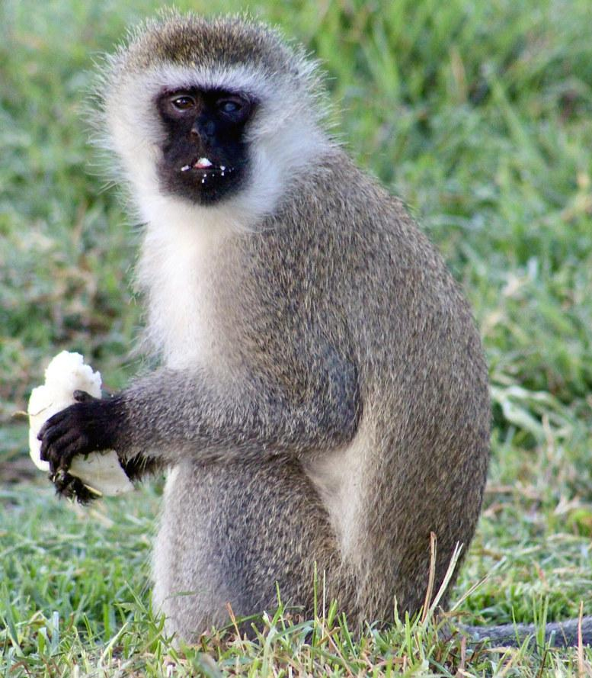
NEUR 411 · NEUROETHOLOGY · FALL 2026
Lecture 38
Primate communication:
vervet monkey alarm calls and referential signaling (Seyfarth & Cheney)
Monday, November 30, 2026
Jordan Lopez, Ph.D.
Professor of Neurobiology & Biomedical Engineering
Photo: Vervet monkey eating a Banana in East African savanna.
Notes:
Primate communication: vervet monkey alarm calls and referential signaling (Seyfarth & Cheney)
Lecture 38. NEUR 411 · NEUROETHOLOGY · FALL 2026. Monday, November 30, 2026.
Image: Photo: Vervet monkey in East African savanna. Credit: Diego Delso. License: CC BY-SA 4.0. Source: https://commons.wikimedia.org/wiki/File:Cercopiteco_verde_(Chlorocebus_pygerythrus),_parque_nacional_de_Tarangire,_Tanzania,_2024-05-24,_DD_02.jpg

Slide 2

Vervet alarms distinguish classes of danger
Alarm calls are vocal signals tied to particular dangers. Free-ranging vervet monkeys, now named Chlorocebus pygerythrus, gave distinct calls when they met terrestrial predators, aerial predators or snakes. Field recordings and observations made over 14 months in Amboseli, Kenya, identified these three categories.
Seyfarth, Cheney and Marler broadcast recorded calls when no predator was present. Monkeys changed where they looked and how they escaped according to the call type, within a 10 s window. Hearing an alarm therefore produced a response even without seeing the predator that usually causes it.
Referential signaling carries information about things and happenings in the external world. Responses that match each predator support a functional reading of the calls. Whether a caller intends to describe a predator, or a listener forms a symbolic representation of one, is a distinct question.
Photo: Vervet monkey in East African savanna.
Seyfarth et al. (1980a); Seyfarth et al. (1980b)
02
Notes:
• **Alarm calls** are vocal signals associated with danger. Free-ranging vervet monkeys, now classified as _Chlorocebus pygerythrus_, produced different calls during encounters with terrestrial predators, aerial predators and snakes. These categories were identified from recordings and observations during a 14-month study in Amboseli, Kenya.
• Seyfarth, Cheney and Marler played recorded calls when predators were absent. Monkeys changed their looking direction and escape behavior according to the call type within the 10 s observation window. The playback separated hearing an alarm from directly seeing its usual eliciting predator.
• **Referential signaling** concerns information about external objects or events. Predator-appropriate responses support that functional interpretation, while leaving unresolved whether a caller intends to describe a predator or a listener represents it in a human-like symbolic form.
References:
Robert M. Seyfarth, Dorothy L. Cheney, Peter Marler (1980). Monkey Responses to Three Different Alarm Calls: Evidence of Predator Classification and Semantic Communication. Science 210(4471):801-803. https://doi.org/10.1126/science.7433999
Robert M. Seyfarth, Dorothy L. Cheney, Peter Marler (1980). Vervet monkey alarm calls: Semantic communication in a free-ranging primate. Animal Behaviour 28(4):1070-1094. https://doi.org/10.1016/S0003-3472(80)80097-2
Image: Photo: Vervet monkey in East African savanna. Credit: Diego Delso. License: CC BY-SA 4.0. Source: https://commons.wikimedia.org/wiki/File:Cercopiteco_verde_(Chlorocebus_pygerythrus),_parque_nacional_de_Tarangire,_Tanzania,_2024-05-24,_DD_02.jpg

Slide 3

Leopard alarms recruit escape into trees
Leopards are terrestrial ambush predators, so an attack can reach a monkey that is moving or feeding on the ground. In Amboseli, alarm calls linked to leopards were followed by movement into trees. The escape destination, more than movement itself, defined the response.
Investigators played the calls through a hidden speaker when no leopard was present, then filmed each recipient before and after the sound. Monkeys on the ground were more likely to run into trees after leopard alarms than after the other alarm categories. Each animal was measured against its own earlier behavior.
An alarm alone can start an appropriate escape before a predator is visually identified. The sound therefore supplies information about where to go as well as when to move, which provides an acoustic route into defensive action. The first movement can therefore be triggered by hearing alone.
Photo: Leopard, a terrestrial ambush predator.
Seyfarth et al. (1980a); Seyfarth et al. (1980b)
03
Notes:
• Leopards are terrestrial ambush predators: an attack can approach a monkey moving or feeding on the ground. In Amboseli, leopard-associated alarm calls were followed by movement into trees. Escape location therefore mattered, rather than movement alone being the relevant response.
• Playback trials used a concealed speaker without a leopard present. The investigators filmed behavior before and after the call, comparing the same recipients across the alarm event. Ground-dwelling subjects were more likely to run into trees after leopard alarms than after the other alarm categories.
• An alarm could initiate an appropriate escape without direct visual identification of the predator. This behavioral result identifies an acoustic contribution to defensive action; it does not establish an obligatory reflex, nor does it measure the neuronal pathway generating the movement.
References:
Robert M. Seyfarth, Dorothy L. Cheney, Peter Marler (1980). Monkey Responses to Three Different Alarm Calls: Evidence of Predator Classification and Semantic Communication. Science 210(4471):801-803. https://doi.org/10.1126/science.7433999
Robert M. Seyfarth, Dorothy L. Cheney, Peter Marler (1980). Vervet monkey alarm calls: Semantic communication in a free-ranging primate. Animal Behaviour 28(4):1070-1094. https://doi.org/10.1016/S0003-3472(80)80097-2
Image: Photo: Leopard, a terrestrial ambush predator. Credit: Charles J. Sharp. License: CC BY-SA 4.0. Source: https://commons.wikimedia.org/wiki/File:Leopard_(Panthera_pardus_pardus)_Kruger.jpg

Slide 4
Leopard alarms draw monkeys into trees
Leopards hunt by ambush on the ground, so a monkey that is feeding or moving low is exposed to attack. In Amboseli, vervet monkeys answered leopard alarms by running into trees. The destination of the escape distinguishes the leopard response from a general reaction to alarm sounds.
Playback used a concealed speaker, and no leopard was present during the trials. Investigators filmed the same recipients before and after each call. Monkeys on the ground ran into trees more often after leopard alarms than after the other alarm categories.
An alarm can therefore start an appropriate escape before any visual identification of the predator. The call guides where the monkey goes as well as how soon it moves. Escape location mattered in these observations, so the sound carried information about refuge as well as danger.
Photo: Leopard, a terrestrial ambush predator.
Seyfarth et al. (1980a); Seyfarth et al. (1980b)
03a
Notes:
• Leopard alarms draw monkeys into trees.
• Ambush.
– Leopards are terrestrial ambush predators, so an attack can approach a monkey feeding or moving across the ground.
– A monkey in the open is exposed, and the escape route matters.
– In Amboseli, leopard-associated alarm calls were followed by movement into trees.
• Playback.
– The calls were broadcast from a concealed speaker.
– No leopard was present during the trials.
– The investigators filmed each recipient before and after the call, so each monkey served as its own baseline.
• Result.
– Ground-dwelling subjects were more likely to run into trees after leopard alarms.
– The other alarm categories produced different movements.
– Escape location therefore mattered, rather than movement alone.
• Visual cue.
– An alarm alone could initiate an appropriate escape.
– The predator did not need to be identified visually first.
– The sound supplied the information that started the movement.
• Meaning.
– The behavior shows an acoustic contribution to defensive action.
– Refuge choice is part of the response that the call organizes.
– The result comes from observed movements of the monkeys in the field.
• Field setting.
– The leopard alarms were recorded in the Amboseli habitat of these monkeys.
– Recipients were on the ground, feeding or moving, when the calls were played.
References:
Robert M. Seyfarth, Dorothy L. Cheney, Peter Marler (1980). Monkey Responses to Three Different Alarm Calls: Evidence of Predator Classification and Semantic Communication. Science 210(4471):801-803. https://doi.org/10.1126/science.7433999
Robert M. Seyfarth, Dorothy L. Cheney, Peter Marler (1980). Vervet monkey alarm calls: Semantic communication in a free-ranging primate. Animal Behaviour 28(4):1070-1094. https://doi.org/10.1016/S0003-3472(80)80097-2

Slide 5
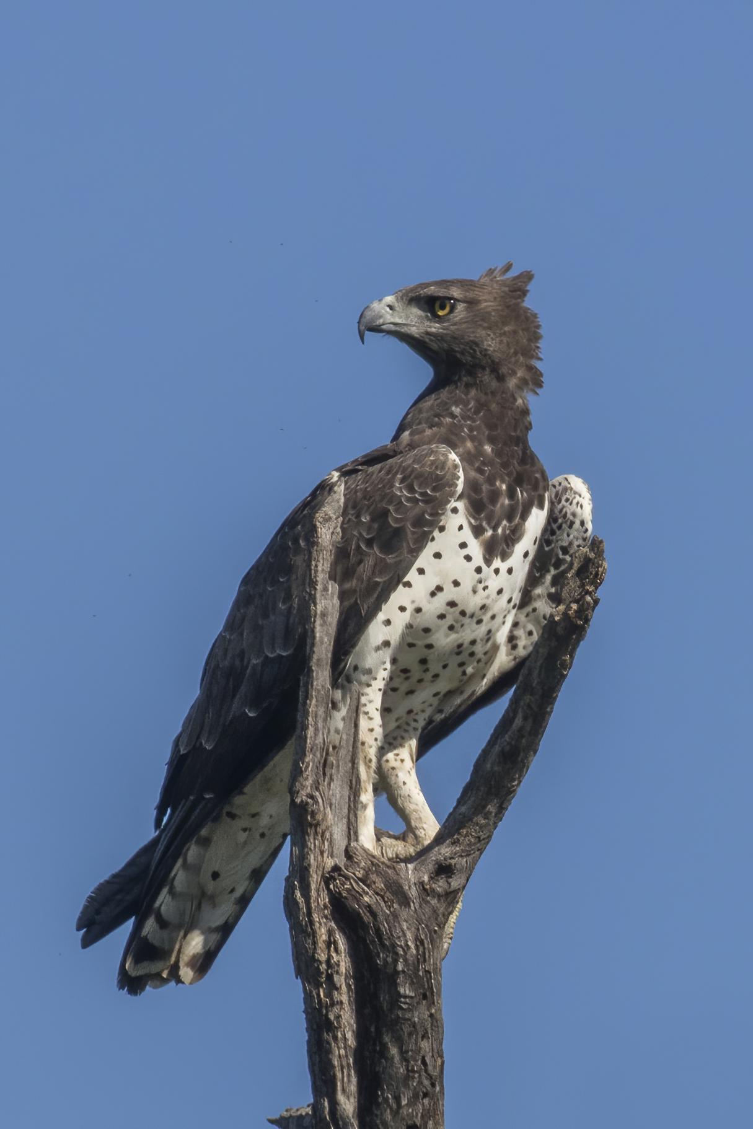
Eagle alarms redirect attention and cover seeking
Martial eagles attack from above, so looking upward and reaching protective cover answer a different threat from climbing away from a leopard. Observers in the same habitat recorded the eagle-associated calls while tracking each monkey's position and subsequent actions.
Playback without an eagle present caused ground-dwelling monkeys to look upward, and some ran into cover. Monkeys already up in trees could come down and leave. Responses in the 10 s after each playback were judged against the 10 s that preceded it.
Where a monkey sits determines how exposed it is, so the same call can lead to different actions. A shared call category therefore allows several motor sequences, and the responses still reveal that monkeys distinguish aerial danger from ground threats.
Photo: Martial eagle, an aerial predator.
Seyfarth et al. (1980a); Seyfarth et al. (1980b)
04
Notes:
• Martial eagles attack from above, so looking upward and reaching protective cover can address a different threat from climbing away from a leopard. Field observers recorded eagle-associated calls while monitoring the recipients’ position and subsequent behavior in the same habitat.
• When these recordings were broadcast without an eagle present, monkeys on the ground looked upward and sometimes ran into cover. Monkeys already in trees could leave the tree. Responses were evaluated during the 10 s after playback against behavior during the preceding 10 s.
• The contrasting actions depend partly on the recipient’s vulnerability at that location. A shared call category need not prescribe one fixed motor sequence. The experiment supports discrimination of aerial danger without demonstrating a representation of a particular individual eagle.
References:
Robert M. Seyfarth, Dorothy L. Cheney, Peter Marler (1980). Monkey Responses to Three Different Alarm Calls: Evidence of Predator Classification and Semantic Communication. Science 210(4471):801-803. https://doi.org/10.1126/science.7433999
Robert M. Seyfarth, Dorothy L. Cheney, Peter Marler (1980). Vervet monkey alarm calls: Semantic communication in a free-ranging primate. Animal Behaviour 28(4):1070-1094. https://doi.org/10.1016/S0003-3472(80)80097-2
Image: Photo: Martial eagle, an aerial predator. Credit: Charles J. Sharp. License: CC BY-SA 4.0. Source: https://commons.wikimedia.org/wiki/File:Martial_eagle_(Polemaetus_bellicosus).jpg

Slide 6
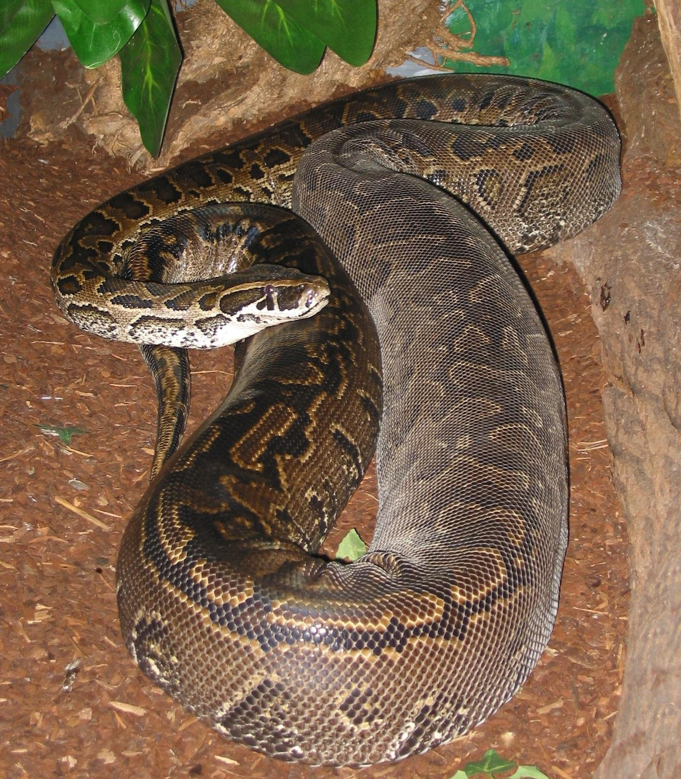
Snake alarms recruit ground-directed inspection
Snake alarms were high-pitched, chutter-like calls given in response to pythons and other threatening snakes. A threat on the ground calls for a different reaction than an attack from the air, so looking down and approaching the snake differed from escaping up a tree.
Predator-free playbacks of snake calls produced more ground-directed looking than the other call types did. Scoring compared each monkey's behavior before and after the broadcast, using one 10 s window. A speaker supplied the sound, and no physical snake was present.
Ground-directed inspection gathers information about a threat that is close by. Calling, looking, approaching and escaping are separate components of the response, and each can occur on its own. Inspection can therefore come before any escape.
Photo: African rock python, a ground-level threat.
Seyfarth et al. (1980a); Seyfarth et al. (1980b)
05
Notes:
• **Snake alarms** were high-pitched chutter-like vocalizations associated with pythons and other threatening snake encounters. Ground-directed inspection can locate a nearby threat whose danger differs from an aerial attack. Looking down and approaching a snake were distinguished from running into a tree.
• In predator-free playbacks, snake calls caused more ground-directed looking than the other call types. The researchers scored behavior before and after the broadcast, using the same 10 s window for comparison. The speaker supplied sound while the physical snake stimulus was absent.
• This contrast supports a relationship between call category and defensive assessment. Inspection is an action that can obtain additional evidence; it is not itself a measurement of conceptual meaning. Calling, looking, approaching and escaping are distinct components of the response.
References:
Robert M. Seyfarth, Dorothy L. Cheney, Peter Marler (1980). Monkey Responses to Three Different Alarm Calls: Evidence of Predator Classification and Semantic Communication. Science 210(4471):801-803. https://doi.org/10.1126/science.7433999
Robert M. Seyfarth, Dorothy L. Cheney, Peter Marler (1980). Vervet monkey alarm calls: Semantic communication in a free-ranging primate. Animal Behaviour 28(4):1070-1094. https://doi.org/10.1016/S0003-3472(80)80097-2
Image: Photo: African rock python, a ground-level threat. Credit: Tigerpython. License: CC BY-SA 3.0. Source: https://commons.wikimedia.org/wiki/File:Adult_Female_Python_sebae.jpg

Slide 7
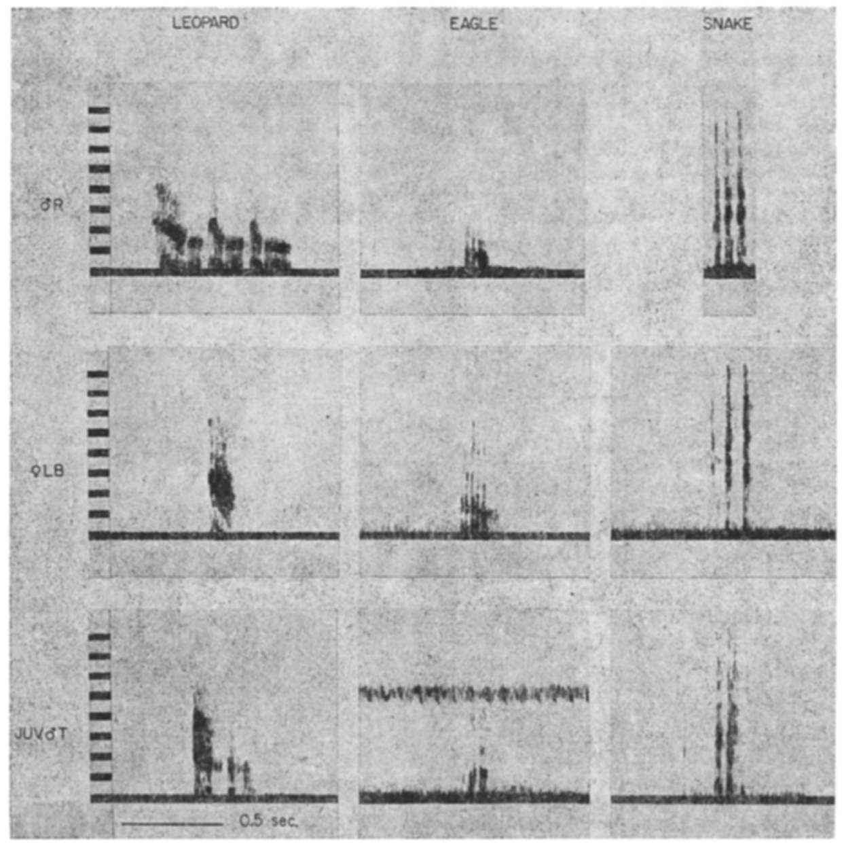
Acoustic structure distinguishes alarm categories
A spectrogram plots acoustic energy against time and frequency. The classic recordings compared leopard, eagle and snake calls from identified adults and one juvenile. Tonal structure, duration and repeated acoustic units become visible on the two axes, which makes the categories straightforward to compare.
The examples were analyzed with a 300 Hz filter and displayed between 80 and 8000 Hz. Eagle alarms carry low-frequency components. Snake alarms have a higher-pitched chutter pattern, and leopard calls combine short tonal units with repeated sequences. Each category has a recognizable acoustic signature.
Field listeners detected these differences as well, so the distinctions exist in the sounds the monkeys hear. Acoustic distinctness provides a basis for discrimination. Playback experiments then test how the monkeys respond, which supplies the behavioral side of the same question.
Seyfarth et al. (1980), Fig. 1. Leopard, eagle and snake alarm spectrograms from three callers.
Seyfarth et al. (1980b)
06
Notes:
• A **spectrogram** represents acoustic energy across time and frequency. The classic recordings compared leopard, eagle and snake calls from identified adults and a juvenile. Horizontal time scales and vertical frequency scales permit comparison of tonal structure, duration and repeated acoustic units.
• The recordings used a 300 Hz analysis filter and frequency displays extending from 80 to 8000 Hz for these examples. Eagle alarms contained low-frequency components, snake alarms had higher-frequency chutter structure, and leopard calls included short tonal units or repeated sequences.
• Differences were detectable both in the recordings and by listeners in the field. Acoustic distinctness establishes a basis for discrimination, but a spectrogram alone cannot establish what monkeys infer. The behavioral playback experiment supplies a separate test of the consequences of hearing these sounds.
References:
Robert M. Seyfarth, Dorothy L. Cheney, Peter Marler (1980). Vervet monkey alarm calls: Semantic communication in a free-ranging primate. Animal Behaviour 28(4):1070-1094. https://doi.org/10.1016/S0003-3472(80)80097-2
Figure: Seyfarth et al. (1980), Fig. 1. Leopard, eagle and snake alarm spectrograms from three callers.
Figure source: https://doi.org/10.1016/S0003-3472(80)80097-2

Slide 8
Spectrograms separate the three alarm calls
Leopard, eagle and snake calls from identified monkeys can be displayed on identical time and frequency axes. That shared layout turns each call into a pattern that can be read and compared. Tonal structure, duration and repeated units then stand out in every category.
Eagle alarms showed low-frequency components in these displays. Snake alarms carried a higher-pitched chutter structure, while leopard calls combined short tonal units with repeated sequences. The frequency range shown for the examples ran from 80 to 8000 Hz.
Because the differences are audible, the calls carry acoustic information before any playback begins. Acoustic distinctness gives discrimination a physical basis. Playback experiments then ask how monkeys act once they hear those sounds.
Seyfarth et al. (1980), Fig. 1. Leopard, eagle and snake alarm spectrograms from three callers.
Seyfarth et al. (1980b)
06a
Notes:
• Spectrograms separate the three alarm calls.
• Display.
– A spectrogram shows acoustic energy across time and frequency.
– Each call category leaves its own pattern on the display.
– Tonal structure, duration and repeated units are visible.
• Settings.
– A 300 Hz analysis filter was used for these examples.
– Frequency displays extended from 80 to 8000 Hz.
– The same axes allow the categories to be compared directly.
• Categories.
– Eagle alarms contained low-frequency components.
– Snake alarms had higher-frequency chutter structure.
– Leopard calls included short tonal units or repeated sequences.
• Field listening.
– Listeners in the field detected these differences.
– The distinctions exist in the sounds the monkeys hear.
– Discrimination rests on acoustic cues that are present in the calls.
• Meaning.
– Playback tests the behavioral consequences of hearing the sounds.
– The recordings give the acoustic basis for those tests.
– Both lines of evidence are needed to link sound and response.
• Axes.
– Time runs along the horizontal axis and frequency along the vertical axis.
– The examples extend from 80 to 8000 Hz.
– Matching the axes makes duration and tonal structure comparable across categories.
References:
Robert M. Seyfarth, Dorothy L. Cheney, Peter Marler (1980). Monkey Responses to Three Different Alarm Calls: Evidence of Predator Classification and Semantic Communication. Science 210(4471):801-803. https://doi.org/10.1126/science.7433999
Robert M. Seyfarth, Dorothy L. Cheney, Peter Marler (1980). Vervet monkey alarm calls: Semantic communication in a free-ranging primate. Animal Behaviour 28(4):1070-1094. https://doi.org/10.1016/S0003-3472(80)80097-2

Slide 9
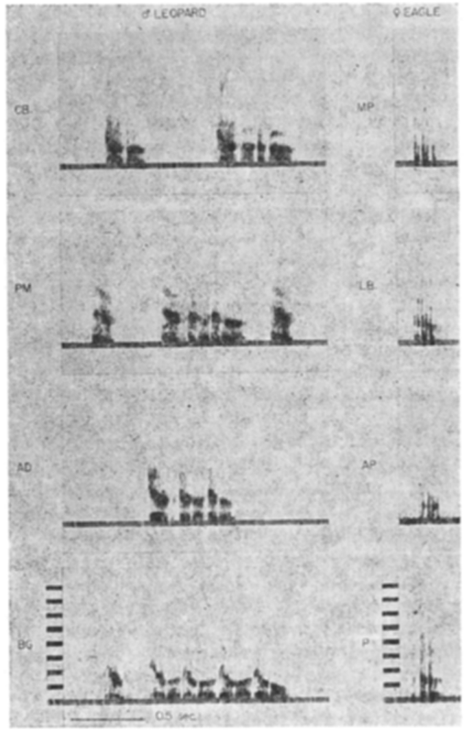
Caller sex changes form within an alarm category
An acoustic unit is a single sound element, whereas a sequence contains several elements. Adult male leopard alarms often consist of repeated units. Female and juvenile leopard alarms can instead consist of one short element, even though the same predator category elicits them.
Seyfarth and colleagues sampled identified individuals instead of assuming that one waveform represents the entire population. Their spectrograms use 0.5 s time scales. Some females also gave multi-unit leopard calls, particularly when a predator was close or attacking. This sampling made variation among callers visible.
Call category and detailed acoustic form describe the same signal at two levels. Callers can therefore differ in form while sharing one behavioral function, and both descriptions remain useful. A category label summarizes the function, while the acoustic form records how the sound is built.
Seyfarth et al. (1980), Fig. 3. Adult male leopard alarms and adult female eagle alarms.
Seyfarth et al. (1980b)
07
Notes:
• An **acoustic unit** is an individual sound element, whereas a sequence contains several such elements. Adult male leopard alarms often consisted of repeated units. Female and juvenile leopard alarms could instead contain a single short element, despite being associated with the same predator category.
• Seyfarth and colleagues compared calls from identified individuals rather than assuming that one waveform represented the entire population. Their spectrograms preserve 0.5 s time scales. Some females also produced multi-unit leopard calls, especially when a predator was close or attacking.
• Call category and detailed acoustic form are therefore related but distinct descriptions. Variation among callers does not eliminate a shared behavioral function. These observations do not by themselves separate effects of sex, body characteristics, threat proximity and individual differences in vocal production.
References:
Robert M. Seyfarth, Dorothy L. Cheney, Peter Marler (1980). Vervet monkey alarm calls: Semantic communication in a free-ranging primate. Animal Behaviour 28(4):1070-1094. https://doi.org/10.1016/S0003-3472(80)80097-2
Figure: Seyfarth et al. (1980), Fig. 3. Adult male leopard alarms and adult female eagle alarms.
Figure source: https://doi.org/10.1016/S0003-3472(80)80097-2

Slide 10
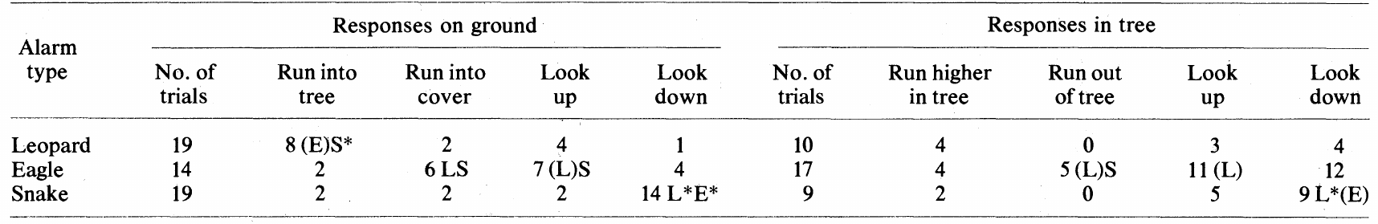
Playback isolates sound from predator visibility
Playback presents a recorded signal to measure its effect on a listener. In the classic field experiment, a speaker was hidden, and leopard, eagle or snake alarms were broadcast when no predator was visible. The orientation of the speaker and the order of calls changed from trial to trial.
The Science report measured the 10 s before each broadcast and the 10 s after it. Ground responses included escape into trees, seeking cover, and looking up or down. Table 1 also sorts monkeys already in trees from monkeys on the ground.
Removing the predator rules out the idea that recipients copied responses to something they could see. The call still carries its acoustic and social information. A response to sound therefore shows what the listener receives, while the caller's own motives need separate observations.
Seyfarth et al. (1980a); Seyfarth et al. (1980b)
08
Notes:
• **Playback** presents a previously recorded signal to test its effect on a recipient. The classic field experiment concealed the loudspeaker and broadcast leopard, eagle or snake alarms when no predator was present. Speaker orientation and call order were varied across trials.
• The Science report compared the 10 s before each broadcast with the 10 s afterward. Ground responses distinguished tree escape, cover seeking and looking up or down. The corresponding table also separates monkeys already in trees from those on the ground.
• Removing the predator addresses the alternative that recipients merely copied responses to something they could see. It leaves acoustic and social information in the call available. A response to sound is evidence about reception, while the caller’s own motives require different observations or manipulations.
References:
Robert M. Seyfarth, Dorothy L. Cheney, Peter Marler (1980). Monkey Responses to Three Different Alarm Calls: Evidence of Predator Classification and Semantic Communication. Science 210(4471):801-803. https://doi.org/10.1126/science.7433999
Robert M. Seyfarth, Dorothy L. Cheney, Peter Marler (1980). Vervet monkey alarm calls: Semantic communication in a free-ranging primate. Animal Behaviour 28(4):1070-1094. https://doi.org/10.1016/S0003-3472(80)80097-2
Figure: Seyfarth et al. (1980), Table 1. Playback responses on the ground and in trees.
Figure source: https://doi.org/10.1126/science.7433999

Slide 11
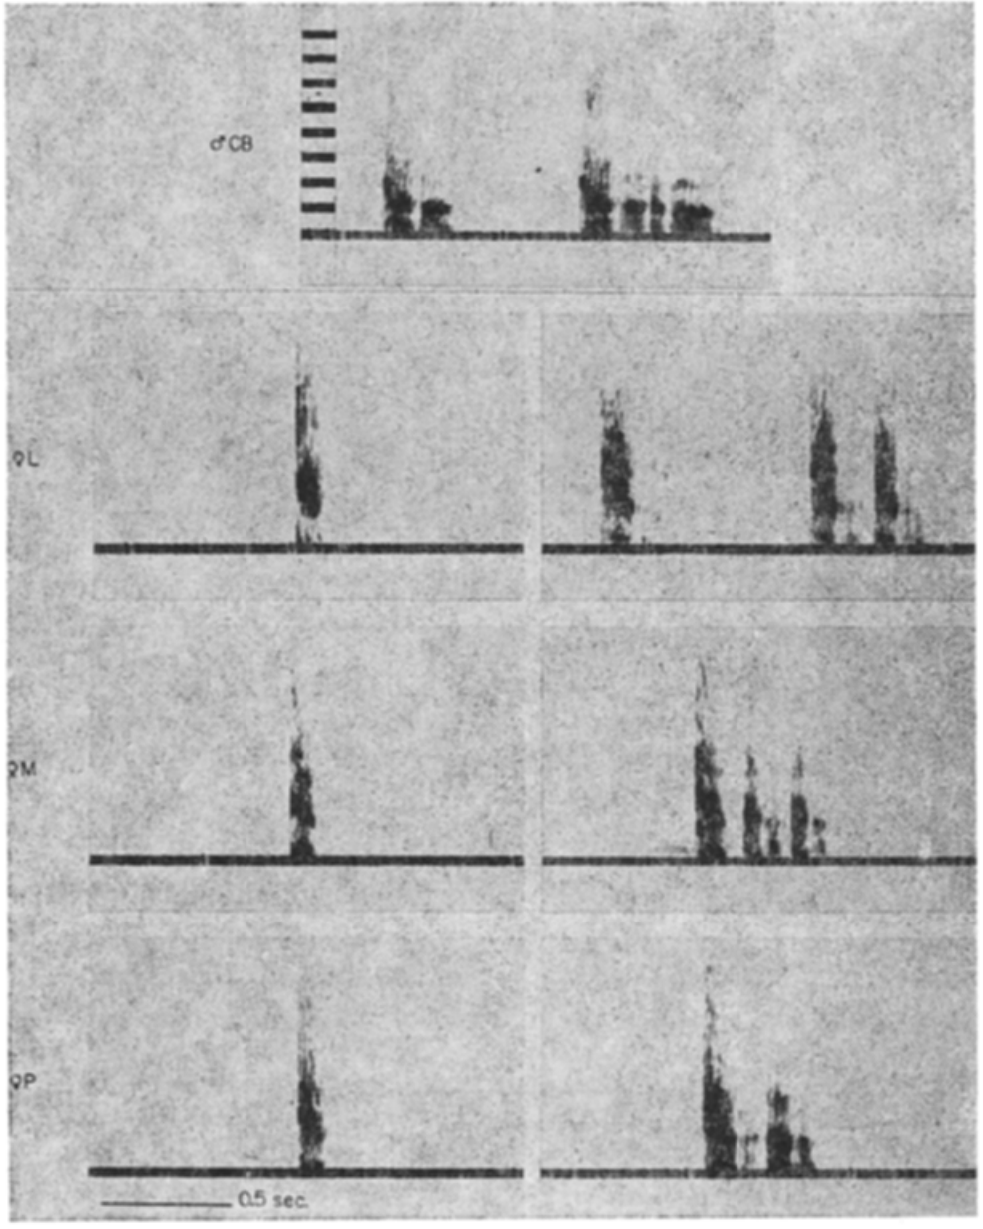
Long and short calls retain category differences
Call duration is the time a vocalization occupies, and longer calls often include more repeated units. Natural recordings allowed the investigators to build short and long versions of each call. Both versions kept the structure typical of their alarm category.
Short stimuli lasted 0.3 s on average and contained a single acoustic unit. Long stimuli averaged 3.7 s and contained roughly five units. Matched recordings from one caller helped separate duration from caller identity, and playback measured the defensive response to each version.
Changing duration left the main differences among leopard, eagle and snake responses intact. Duration by itself therefore explains little of these category differences. Urgency and response magnitude still change with duration, independent of which action is chosen.
Seyfarth et al. (1980), Fig. 4. Single-unit and multi-unit leopard alarms.
Seyfarth et al. (1980b); Seyfarth et al. (1980a)
09
Notes:
• Call **duration** is the time occupied by the vocalization; a longer call can also contain more repeated units. Natural recordings permitted the investigators to construct short and long versions while retaining the characteristic structure associated with each alarm category.
• Short stimuli averaged 0.3 s and contained one acoustic unit. Long stimuli averaged 3.7 s and contained approximately five units. Matched recordings from the same caller helped separate duration from differences in caller identity, and playback compared the resulting defensive responses.
• Changing duration did not erase the principal differences between response categories. The result argues against duration alone explaining leopard, eagle and snake responses. It does not imply that duration is behaviorally irrelevant, because urgency and response magnitude can vary independently of the kind of action selected.
References:
Robert M. Seyfarth, Dorothy L. Cheney, Peter Marler (1980). Vervet monkey alarm calls: Semantic communication in a free-ranging primate. Animal Behaviour 28(4):1070-1094. https://doi.org/10.1016/S0003-3472(80)80097-2
Robert M. Seyfarth, Dorothy L. Cheney, Peter Marler (1980). Monkey Responses to Three Different Alarm Calls: Evidence of Predator Classification and Semantic Communication. Science 210(4471):801-803. https://doi.org/10.1126/science.7433999
Figure: Seyfarth et al. (1980), Fig. 4. Single-unit and multi-unit leopard alarms.
Figure source: https://doi.org/10.1016/S0003-3472(80)80097-2

Slide 12
Duration alone leaves category differences intact
Duration is one property that differs between versions of one call. Natural recordings let investigators build short and long versions while preserving the characteristic structure of each alarm category. A longer call often contains more repeated units than a shorter one.
The short stimuli were about 0.3 s long, with one acoustic unit each. The long stimuli ran about 3.7 s and held roughly five units. Each caller contributed matched recordings, which kept caller identity constant across versions, and playback then measured the response to each length.
The category differences survived the change in length. Length therefore contributes less to the response category than other properties do. Urgency and response size, however, can change with length, separately from which action is chosen.
Seyfarth et al. (1980), Fig. 4. Single-unit and multi-unit leopard alarms.
Seyfarth et al. (1980b); Seyfarth et al. (1980a)
09a
Notes:
• Duration alone leaves category differences intact.
• Duration.
– Duration is the time a vocalization occupies.
– A longer call can also contain more repeated units.
– Natural recordings made both short and long versions possible.
• Stimuli.
– Short versions averaged 0.3 s and held one acoustic unit.
– Long versions averaged 3.7 s and held about five units.
– Each version kept the structure typical of its alarm category.
• Control.
– Matched recordings came from the same caller.
– Caller identity was kept separate from duration.
– The playback measured the defensive response to each version.
• Result.
– The main differences between response categories persisted.
– Duration therefore accounts for little of the category differences.
– The leopard, eagle and snake responses stayed distinct.
• Meaning.
– Urgency and response magnitude still change with duration.
– These measures vary independently of the action selected.
– The type of action is set by other features of the call.
• Repeated units.
– A longer call can contain more repeated units than a shorter one.
– Matched recordings from one caller kept caller identity constant.
– Short and long versions preserved the structure of their category.
References:
Robert M. Seyfarth, Dorothy L. Cheney, Peter Marler (1980). Monkey Responses to Three Different Alarm Calls: Evidence of Predator Classification and Semantic Communication. Science 210(4471):801-803. https://doi.org/10.1126/science.7433999
Robert M. Seyfarth, Dorothy L. Cheney, Peter Marler (1980). Vervet monkey alarm calls: Semantic communication in a free-ranging primate. Animal Behaviour 28(4):1070-1094. https://doi.org/10.1016/S0003-3472(80)80097-2

Slide 13
Amplitude alone does not explain alarm responses
Amplitude describes how loud a sound is, whereas acoustic structure covers the frequency distribution and timing pattern of a call. The natural calls varied in loudness. Reconstructed field playback levels averaged 56 dB for leopard alarms, 53 dB for eagle alarms and 48 dB for snake alarms.
The investigators also sorted responses where amplitude ranges overlapped, and they ran trials with equalized amplitude. Category differences in defensive behavior held up in both analyses. These controls indicate that the categories reflect different kinds of action rather than a general disturbance from louder sounds.
Sound level therefore falls short as a full explanation for the category-specific actions in this preparation. Sound level, caller state and external danger can change together, yet each one contributes its own variable to the response. Each variable is measured separately, so the response can be attributed to its own source.
Seyfarth et al. (1980), Fig. 1. Leopard, eagle and snake alarm spectrograms from three callers.
Seyfarth et al. (1980b); Seyfarth et al. (1980a)
10
Notes:
• **Amplitude** concerns sound magnitude, while acoustic structure includes its frequency distribution and temporal pattern. The natural calls differed in loudness: reconstructed field playback levels averaged 56 dB for leopard alarms, 53 dB for eagle alarms and 48 dB for snake alarms.
• The investigators also compared responses where amplitude ranges overlapped and conducted amplitude-equalized trials. Category differences in defensive behavior persisted. These controls addressed whether louder sounds simply produced a different degree of generalized disturbance rather than a different kind of response.
• The evidence rejects amplitude as a sufficient explanation for the category-specific actions in this preparation. It does not establish that internal arousal contributes nothing to natural calling. Sound level, caller state and external danger can covary without being interchangeable explanations for every measured response.
References:
Robert M. Seyfarth, Dorothy L. Cheney, Peter Marler (1980). Vervet monkey alarm calls: Semantic communication in a free-ranging primate. Animal Behaviour 28(4):1070-1094. https://doi.org/10.1016/S0003-3472(80)80097-2
Robert M. Seyfarth, Dorothy L. Cheney, Peter Marler (1980). Monkey Responses to Three Different Alarm Calls: Evidence of Predator Classification and Semantic Communication. Science 210(4471):801-803. https://doi.org/10.1126/science.7433999
Figure: Seyfarth et al. (1980), Fig. 1. Leopard, eagle and snake alarm spectrograms from three callers.
Figure source: https://doi.org/10.1016/S0003-3472(80)80097-2

Slide 14
Receiver location changes the available escape action
Context includes the recipient's surroundings and position when a signal arrives. The classic experiments tested ground-dwelling subjects and tree-dwelling subjects, so the same alarm category was evaluated where refuge and vulnerability differed. Position therefore becomes part of the stimulus.
Ground subjects commonly moved upward after leopard alarms. Eagle alarms could make tree-dwelling monkeys leave the tree. Each 10 s scoring window set these actions against the individual's own behavior before playback, so every movement was classified separately.
A stable link between an alarm and a danger class is compatible with context-dependent action. The same external threat can call for different movements from different starting points. Different calls also produced contrasting responses in one setting, so context shaped the action without replacing the call's information.
Seyfarth et al. (1980a); Seyfarth et al. (1980b)
11
Notes:
• **Context** includes the recipient’s surroundings and position when a signal arrives. The classic experiments tested subjects on the ground and subjects in trees, allowing the same alarm category to be evaluated where available refuge and vulnerability differed.
• Ground subjects commonly escaped upward after leopard alarms, whereas eagle alarms could make tree-dwelling monkeys leave the tree. The 10 s scoring windows compared these actions with each individual’s behavior before playback, rather than treating all movement as one defensive response.
• A stable association with a danger class is compatible with context-dependent action. The same external threat can demand different movements from different starting positions. These experiments did not support a context-only account of all alarm distinctions, because different calls also elicited contrasting responses in the same setting.
References:
Robert M. Seyfarth, Dorothy L. Cheney, Peter Marler (1980). Monkey Responses to Three Different Alarm Calls: Evidence of Predator Classification and Semantic Communication. Science 210(4471):801-803. https://doi.org/10.1126/science.7433999
Robert M. Seyfarth, Dorothy L. Cheney, Peter Marler (1980). Vervet monkey alarm calls: Semantic communication in a free-ranging primate. Animal Behaviour 28(4):1070-1094. https://doi.org/10.1016/S0003-3472(80)80097-2
Figure: Seyfarth et al. (1980), Table 1. Playback responses on the ground and in trees.
Figure source: https://doi.org/10.1126/science.7433999

Slide 15
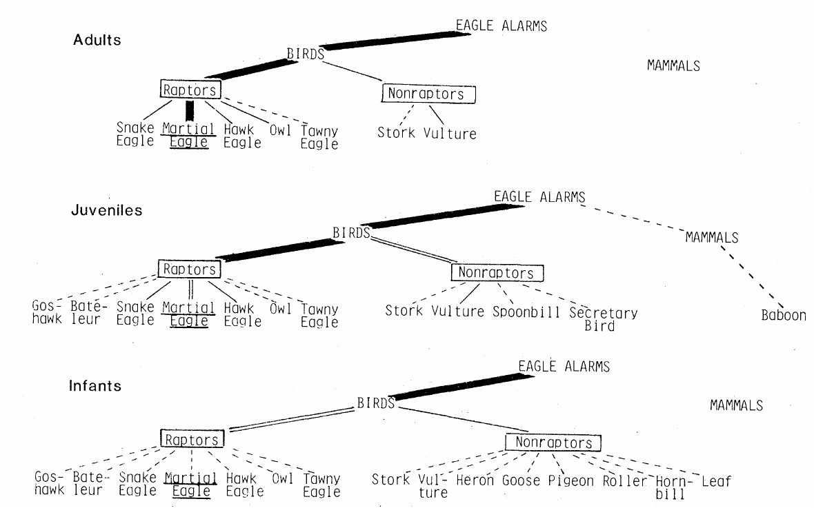
Infants classify threats more broadly than adults
Ontogeny refers to change during an individual's development. In Amboseli, infants gave eagle alarms to many birds and sometimes to harmless objects. Adult callers restricted these alarms more strongly to dangerous aerial species, including martial eagles. The narrowing took place over the course of development.
Alarms collected over 14 months show the stimuli linked to infant, juvenile and adult calling. Infant errors were systematic. Aerial stimuli usually drew eagle calls, terrestrial mammals usually drew leopard calls, and long thin objects usually drew snake calls.
The developmental pattern fits refinement within broad perceptual categories. Infants already sort threats into those categories, and experience narrows which stimuli trigger each call. Juvenile patterns fall between the infant and adult patterns.
Seyfarth et al. (1980), Fig. 1. Age-related breadth of stimuli eliciting eagle alarms.
Seyfarth et al. (1980a)
12
Notes:
• **Ontogeny** is change during an individual’s development. In the Amboseli observations, infants gave eagle alarms to a broad range of birds and sometimes to harmless stimuli. Adult callers restricted such alarms more strongly to dangerous aerial species, including martial eagles.
• The published comparison follows alarms collected across 14 months and displays the stimuli associated with infant, juvenile and adult calling. Infants’ errors were structured: aerial stimuli tended to elicit eagle calls, terrestrial mammals leopard calls, and long thin objects snake calls.
• The developmental difference is consistent with refinement within broad perceptual categories. It does not mean infants begin without discrimination. Because these were observations across age classes, the contribution of maturation, personal experience and learning from adults could not be isolated by this comparison alone.
References:
Robert M. Seyfarth, Dorothy L. Cheney, Peter Marler (1980). Monkey Responses to Three Different Alarm Calls: Evidence of Predator Classification and Semantic Communication. Science 210(4471):801-803. https://doi.org/10.1126/science.7433999
Figure: Seyfarth et al. (1980), Fig. 1. Age-related breadth of stimuli eliciting eagle alarms.
Figure source: https://doi.org/10.1126/science.7433999

Slide 16
Infants give eagle alarms to many birds
Infant monkeys in Amboseli gave eagle alarms to many birds, and sometimes to harmless objects. Adults limited these alarms to dangerous aerial species, including martial eagles. That narrowing with age is the developmental change documented in this study.
Records from the 14-month study tie each infant, juvenile or adult call to the object that triggered it. Infant errors had structure: aerial objects drew eagle calls, terrestrial mammals drew leopard calls, and long thin objects drew snake calls.
Calls become tied to fewer, more dangerous species as monkeys mature. The change refines categories that infants already use, so the broad categories come first and the narrow ones follow with experience. Juveniles fall between the infant and adult patterns along the same path.
Seyfarth et al. (1980), Fig. 1. Age-related breadth of stimuli eliciting eagle alarms.
Seyfarth et al. (1980a)
12a
Notes:
• Infants give eagle alarms to many birds.
• Ontogeny.
– Ontogeny is change during an individual's development.
– Infant alarms covered a broad range of stimuli.
– Some infant alarms were given to harmless objects.
• Adults.
– Adult callers restricted eagle alarms more strongly.
– The restriction favored dangerous aerial species.
– Martial eagles were among the species that adults alarmed to.
• Errors.
– Infant errors followed a category structure.
– Aerial stimuli tended to draw eagle calls.
– Terrestrial mammals tended to draw leopard calls, and long thin objects drew snake calls.
• Juveniles.
– Juvenile patterns fell between infant and adult patterns.
– Calling became more selective with age.
– The 14-month field records linked each call to its eliciting object.
• Meaning.
– Development refines broad categories.
– Experience narrows the set of stimuli that trigger each call.
– The developmental change is a refinement rather than a new discrimination.
• Juvenile pattern.
– Juvenile calling sat between the broad infant pattern and the selective adult pattern.
– The eagle-alarm comparison was built from alarms collected over the 14-month study.
– Age-related change is visible within that single data set.
References:
Robert M. Seyfarth, Dorothy L. Cheney, Peter Marler (1980). Vervet monkey alarm calls: Semantic communication in a free-ranging primate. Animal Behaviour 28(4):1070-1094. https://doi.org/10.1016/S0003-3472(80)80097-2

Slide 17
Development refines recognition within broad classes
Predator classification assigns encountered objects to threat categories. Adults met many harmless species without alarming, and they called more selectively to predators relevant to their habitat. Earlier developmental observations set these narrower adult associations against the broad categories of infants.
The eagle-alarm data cover raptors, other birds, and a few additional stimuli. Records gathered during a 14-month field study tied each call to the object that elicited it. Juvenile patterns fell between the broad infant pattern and the selective adult pattern.
The change concerns when existing calls are used, rather than the acquisition of new acoustic forms. Calls are used in narrower settings as monkeys mature, and age-related refinement supports experience-sensitive categorization in these callers.
Seyfarth et al. (1980), Fig. 1. Age-related breadth of stimuli eliciting eagle alarms.
Seyfarth et al. (1980a)
13
Notes:
• **Predator classification** assigns different encountered objects to threat categories. The classic developmental observations contrasted broad infant categories with narrower adult associations. Adults encountered many harmless species without alarming and more selectively called to predators relevant to the local habitat.
• The eagle-alarm comparison includes raptors, non-raptor birds and occasional other stimuli. Records accumulated during a 14-month field study linked each call to an identified eliciting object. Juvenile patterns lay between the broad infant and more selective adult patterns.
• This relationship concerns the use of a call, not necessarily the acquisition of a new acoustic form. The original authors left the learning process unresolved. Age-related refinement supports experience-sensitive categorization, while controlled changes in experience are needed to identify how social and individual information contribute.
References:
Robert M. Seyfarth, Dorothy L. Cheney, Peter Marler (1980). Monkey Responses to Three Different Alarm Calls: Evidence of Predator Classification and Semantic Communication. Science 210(4471):801-803. https://doi.org/10.1126/science.7433999
Figure: Seyfarth et al. (1980), Fig. 1. Age-related breadth of stimuli eliciting eagle alarms.
Figure source: https://doi.org/10.1126/science.7433999

Slide 18
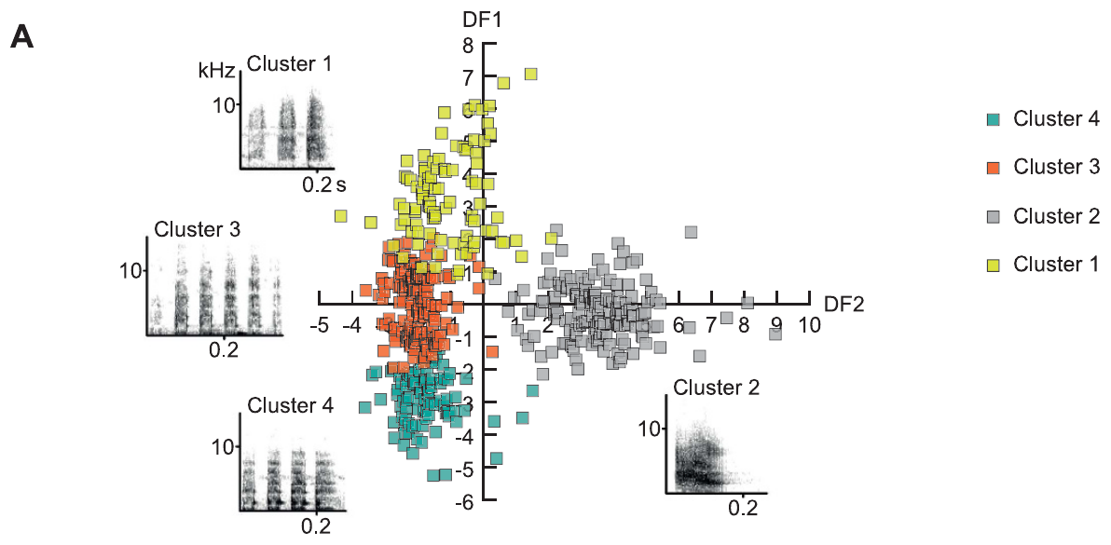
Female calls occupy several acoustic clusters
An acoustic cluster groups calls with similar measured properties before any predator name is assigned. Price and colleagues analyzed recordings made during predator encounters and aggressive interactions. Female calls fell into four broad groups that differed in element length and frequency distribution.
Spectrograms show frequency in kHz and time in seconds, with representative elements drawn on 0.2 s scales. Some clusters contained repeated short sounds, while one terrestrial-predator cluster contained fewer and longer elements. The analysis built upon earlier qualitative descriptions.
Clustering reveals organization in the recorded repertoire, which describes how calls are produced. Acoustically similar sounds can occur in more than one behavioral setting, so the number of clusters belongs to the recordings themselves. Clusters therefore summarize production before any meaning is assigned.
Price et al. (2015), Fig. 1A. Acoustic clusters of female calls across predator and aggressive contexts.
Price et al. (2015)
14
Notes:
• An **acoustic cluster** groups calls with similar measured sound properties without first assigning them a predator name. Price and colleagues analyzed recordings from predator encounters and aggressive interactions. Female calls separated into four broad groups with differences in element length and frequency distribution.
• The source spectrograms display frequency in kHz and time in seconds; representative elements are shown against 0.2 s scales. Some clusters contained repeated short sounds, whereas a terrestrial-predator-associated cluster contained fewer, longer elements. This analysis extended the classic qualitative descriptions.
• Clustering establishes structure in the recorded repertoire rather than a neural category boundary. A group of acoustically similar sounds can occur in more than one behavioral setting. The number of analytical clusters does not itself establish the number of meanings recognized by a monkey.
References:
Tabitha Price, Philip Wadewitz, Dorothy Cheney, Robert Seyfarth, Kurt Hammerschmidt, Julia Fischer (2015). Vervets revisited: A quantitative analysis of alarm call structure and context specificity. Scientific Reports 5(1):13220. https://doi.org/10.1038/srep13220
Figure: Price et al. (2015), Fig. 1A. Acoustic clusters of female calls across predator and aggressive contexts.
Figure source: https://doi.org/10.1038/srep13220

Slide 19
Time and frequency contribute different call features
Temporal features describe duration and spacing, whereas spectral features describe how energy is spread across frequencies. Price and colleagues measured both kinds, instead of defining alarm types from one frequency or one duration. The examples keep their original kHz and second scales.
Calls given to terrestrial predators by females contained longer single elements than calls for aerial and snake encounters. Mean element durations were 107.7 ms for terrestrial encounters, 43.9 ms for aerial encounters and 38.3 ms for snake encounters. These values refer to single elements, not complete alarm bouts.
Several features can support discrimination together, even when no single measure draws a perfect boundary between categories. Controlled changes to playback stimuli are the method for attributing discrimination to one feature. Such experiments turn a correlation in the recordings into a tested link between sound and response.
Price et al. (2015), Fig. 1A. Acoustic clusters of female calls across predator and aggressive contexts.
Price et al. (2015)
15
Notes:
• **Temporal features** describe duration and spacing; **spectral features** describe how energy is distributed across frequencies. Price and colleagues measured both rather than identifying alarm types from one frequency or one duration alone. The acoustic examples retain their original kHz and second scales.
• Female terrestrial-predator calls had longer individual elements than aerial and snake-associated calls. Reported mean element durations were 107.7 ms for terrestrial encounters, 43.9 ms for aerial encounters and 38.3 ms for snake encounters. These measurements concern elements rather than entire alarm bouts.
• Multiple features can support discrimination even when no single measure creates a perfect boundary. The analysis describes the recorded calls; it does not identify which feature a listener actually uses. Controlled playback changes would be needed to attribute behavioral discrimination to one feature independently.
References:
Tabitha Price, Philip Wadewitz, Dorothy Cheney, Robert Seyfarth, Kurt Hammerschmidt, Julia Fischer (2015). Vervets revisited: A quantitative analysis of alarm call structure and context specificity. Scientific Reports 5(1):13220. https://doi.org/10.1038/srep13220
Figure: Price et al. (2015), Fig. 1A. Acoustic clusters of female calls across predator and aggressive contexts.
Figure source: https://doi.org/10.1038/srep13220

Slide 20
Element duration differs across predator contexts
Duration and spacing make up the temporal side of a call, and energy spread across frequencies makes up the spectral side. The analysis measured both sides in the same recordings, so no single frequency or duration defined an alarm type.
Individual elements were longest in calls given to terrestrial predators. Their mean duration was 107.7 ms. Aerial encounters averaged 43.9 ms and snake encounters averaged 38.3 ms, values that describe single elements rather than whole bouts.
Each feature contributes part of the information in the call, and no single feature forms a perfect boundary. Attributing the discrimination to one feature requires playback in which that feature alone is changed. Such playback tests connect a specific acoustic change to the behavior that follows it.
Price et al. (2015), Fig. 1A. Acoustic clusters of female calls across predator and aggressive contexts.
Price et al. (2015)
15a
Notes:
• Element duration differs across predator contexts.
• Features.
– Temporal and spectral features were measured together.
– Duration and spacing describe timing.
– Energy distribution describes the spectrum.
• Elements.
– Terrestrial elements were longer than aerial and snake elements.
– Element durations were reported in milliseconds.
– The values refer to elements, not to whole bouts.
• Values.
– Terrestrial encounters averaged 107.7 ms per element.
– Aerial encounters averaged 43.9 ms.
– Snake encounters averaged 38.3 ms.
• Bouts.
– A bout can contain successive vocalizations.
– Element measures are a different unit from the bout.
– Each measure describes a different biological level.
• Meaning.
– Several features support discrimination together.
– Playback manipulations isolate a single feature.
– The combined features give listeners more than one cue.
• Measurement levels.
– Element duration describes one component of a compound call.
– Bout-level measures describe the full vocalization sequence.
– The source analysis reports both levels for the same female calls.
– Element counts and element durations were reported together for snake and terrestrial calls.
– The two levels were kept separate in the analysis to avoid treating every duration as the same unit.
References:
Tabitha Price, Philip Wadewitz, Dorothy Cheney, Robert Seyfarth, Kurt Hammerschmidt, Julia Fischer (2015). Vervets revisited: A quantitative analysis of alarm call structure and context specificity. Scientific Reports 5(1):13220. https://doi.org/10.1038/srep13220

Slide 21
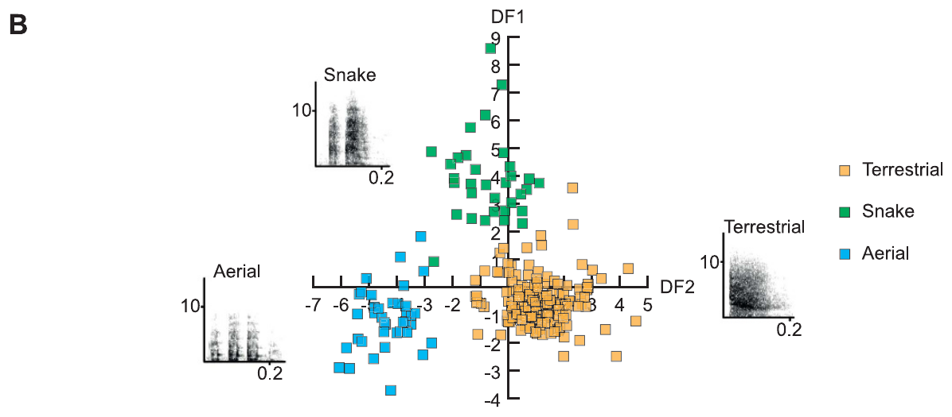
Female predator calls remain acoustically distinct
Production specificity is the link between a signal and the situations in which it is produced. Limiting the analysis to predator encounters, Price and colleagues compared female calls recorded during aerial, snake and terrestrial threats. The acoustic distributions for these three contexts separated strongly.
Spectral measurements help separate these contexts. Average peak frequencies came to 986 Hz in aerial calls, 2840 Hz in snake calls and 2374 Hz in terrestrial calls. Temporal structure also differed, so peak frequency was one feature among several in the classification.
The distinctions hold among the three predator contexts in this data set. Aggressive encounters were analyzed separately, in a later comparison of the same recordings. Specificity therefore depends on which alternative situations the analysis includes.
Price et al. (2015), Fig. 1B. Female calls separated by predator context.
Price et al. (2015)
16
Notes:
• **Production specificity** is the association between a signal and the situations in which it is produced. Restricting their analysis to predator encounters, Price and colleagues compared female calls recorded during aerial, snake and terrestrial threats. The corresponding acoustic distributions separated strongly.
• Spectral measurements help distinguish these contexts. Mean peak frequency was 986 Hz for aerial calls, 2840 Hz for snake calls and 2374 Hz for terrestrial calls. Temporal structure also differed, so peak frequency was not the sole basis of classification.
• The result supports acoustic differences among predator-associated female calls in this data set. It does not establish that those sounds occur only with predators, because aggressive contexts were excluded from this particular comparison. Specificity depends on which alternative eliciting situations are actually examined.
References:
Tabitha Price, Philip Wadewitz, Dorothy Cheney, Robert Seyfarth, Kurt Hammerschmidt, Julia Fischer (2015). Vervets revisited: A quantitative analysis of alarm call structure and context specificity. Scientific Reports 5(1):13220. https://doi.org/10.1038/srep13220
Figure: Price et al. (2015), Fig. 1B. Female calls separated by predator context.
Figure source: https://doi.org/10.1038/srep13220

Slide 22
A call element is not the entire alarm bout
A call element is a component within a compound vocalization, and a bout can contain several successive vocalizations. Price and colleagues separated measures of the whole call from spectral measures of its individual elements. This avoids assuming that every duration refers to the same biological unit.
Snake-linked calls from females had more brief elements than calls linked to terrestrial predators. Mean element numbers were 4.1 for snake calls and 1.4 for terrestrial calls. Mean element durations were 38.3 ms and 107.7 ms, so the two arrangements gave contrasting temporal patterns.
These measurements connect acoustic organization to the eliciting context without equating each call with a fixed word. A listener could combine the pattern with frequency and social cues. The temporal pattern and the frequency content are two inputs the listener can use together.
Price et al. (2015), Fig. 1B. Female calls separated by predator context.
Price et al. (2015)
17
Notes:
• A **call element** is a component within a compound vocalization; a **bout** can contain successive vocalizations. Price and colleagues separated measures of the complete call from spectral measures of its individual elements, avoiding the assumption that every duration describes the same biological unit.
• Female snake-associated calls contained more short elements than terrestrial-predator calls. Reported mean element numbers were 4.1 for snake calls and 1.4 for terrestrial calls, while their mean element durations were 38.3 ms and 107.7 ms respectively. Different arrangements therefore produced contrasting temporal patterns.
• These source measurements connect acoustic organization to the eliciting context without claiming a one-to-one translation into a word. A listener could use the pattern jointly with frequency and social information. The recordings alone do not determine whether element count is represented separately by the auditory system.
References:
Tabitha Price, Philip Wadewitz, Dorothy Cheney, Robert Seyfarth, Kurt Hammerschmidt, Julia Fischer (2015). Vervets revisited: A quantitative analysis of alarm call structure and context specificity. Scientific Reports 5(1):13220. https://doi.org/10.1038/srep13220
Figure: Price et al. (2015), Fig. 1B. Female calls separated by predator context.
Figure source: https://doi.org/10.1038/srep13220

Slide 23
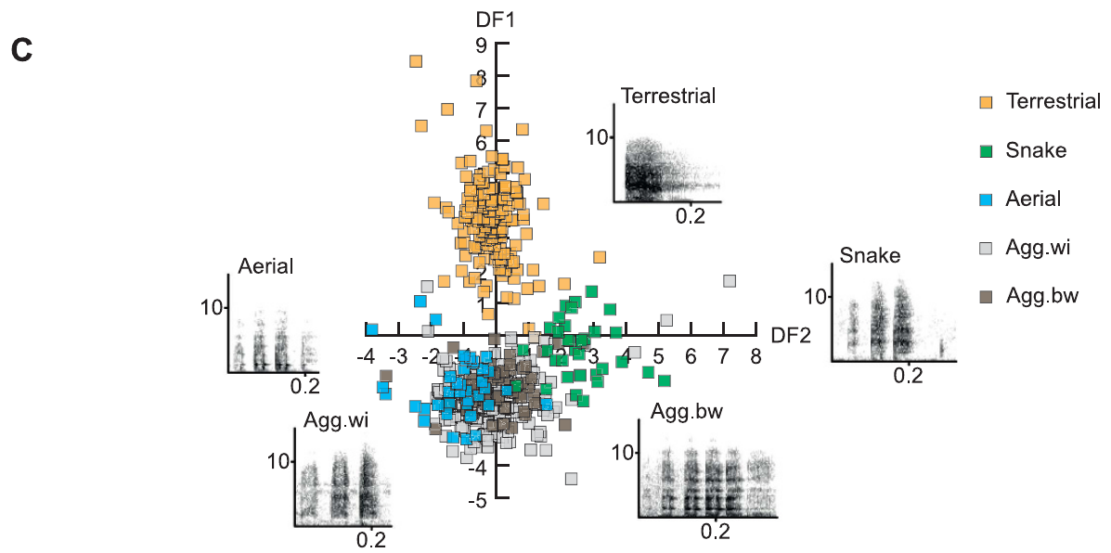
Aggression overlaps with female alarm acoustics
Aggression consists of antagonistic interactions within groups or between them. Price and colleagues included these aggressive recordings in the analysis of female predator calls. Calls linked to snakes and aerial predators then overlapped with aggressive calls, which weakens a simple one-call, one-predator description.
Snake calls with a chutter-like sound resembled some intergroup calls. Aerial calls with a rraup-like sound resembled calls given during escalated aggression. Mean peak frequencies during between-group and within-group aggression were 1715 Hz and 1456 Hz, both inside the wider range of predator-associated calls.
Acoustic structure often matches several contexts at once, so context must be inferred from more than one feature. Recipients also weigh further acoustic details and the current situation, and those factors can shape how they respond to the same call.
Price et al. (2015), Fig. 1C. Female predator and aggression calls occupy overlapping acoustic space.
Price et al. (2015)
18
Notes:
• **Aggression** comprises antagonistic interactions within or between groups. Price and colleagues added recordings from these situations to the female predator-call analysis. Calls associated with snakes and aerial predators then overlapped with aggressive calls, weakening a simple one-call–one-predator description.
• Snake-associated chutter-like sounds resembled some intergroup calls. Aerial-associated rraup-like sounds resembled sounds from escalated aggression. Mean peak frequencies during between-group and within-group aggression were 1715 Hz and 1456 Hz, within the broader range occupied by predator-associated calls.
• Production context cannot always be read directly from acoustic structure. This finding does not eliminate information available to recipients: additional acoustic details and current circumstances can influence their response. It does restrict claims that every familiar alarm form is exclusively a label for one predator class.
References:
Tabitha Price, Philip Wadewitz, Dorothy Cheney, Robert Seyfarth, Kurt Hammerschmidt, Julia Fischer (2015). Vervets revisited: A quantitative analysis of alarm call structure and context specificity. Scientific Reports 5(1):13220. https://doi.org/10.1038/srep13220
Figure: Price et al. (2015), Fig. 1C. Female predator and aggression calls occupy overlapping acoustic space.
Figure source: https://doi.org/10.1038/srep13220

Slide 24
Aggressive calls overlap predator call forms
Price and colleagues looked at aggressive recordings from both within-group and between-group conflicts. When those calls joined the female predator-call set, snake and aerial calls overlapped with them. A single call type therefore no longer matched a single predator.
The chutter-like snake sounds looked acoustically similar to some intergroup calls. The rraup-like aerial sounds also matched sounds from escalated aggression. Between-group and within-group peak frequencies averaged 1715 Hz and 1456 Hz, values inside the predator range.
Recipients therefore need more than the call form to decide what it means. Additional acoustic details and the immediate social situation give them that information. Each source adds a different kind of information to the same call form. The overlap gives listeners ambiguous cues in some cases.
Price et al. (2015), Fig. 1C. Female predator and aggression calls occupy overlapping acoustic space.
Price et al. (2015)
18a
Notes:
• Aggressive calls overlap predator call forms.
• Aggression.
– Aggression includes antagonistic interactions within and between groups.
– Aggressive recordings were added to the female analysis.
– The added recordings came from the same study system.
• Overlap.
– Snake calls with a chutter-like sound resembled some intergroup calls.
– Aerial calls with a rraup-like sound resembled escalated aggression.
– The overlap weakens a one-call, one-predator description.
• Peaks.
– Between-group aggression had a mean peak of 1715 Hz.
– Within-group aggression had a mean peak of 1456 Hz.
– Both values fall within the range of predator-associated calls.
• Recipients.
– Additional acoustic details shape the response.
– Current circumstances also shape the response.
– Recipients combine several sources of information.
• Meaning.
– Context must be inferred from several features.
– Production context cannot always be read from structure alone.
– The same call form can appear in different settings.
• Source scales.
– The spectrograms of these calls use 0.2 s time scales and kHz axes.
– Mean peak frequencies are reported for between-group and within-group aggression.
– Both values fall inside the spread of predator-associated calls.
References:
Tabitha Price, Philip Wadewitz, Dorothy Cheney, Robert Seyfarth, Kurt Hammerschmidt, Julia Fischer (2015). Vervets revisited: A quantitative analysis of alarm call structure and context specificity. Scientific Reports 5(1):13220. https://doi.org/10.1038/srep13220

Slide 25
Graded variation differs from discrete call types
Graded variation consists of intermediate forms along acoustic dimensions. Discrete categories, by contrast, have clearer boundaries between them. Female chutter-like and rraup-like calls occupied overlapping acoustic space once aggressive contexts were added, and the distributions come from measured features rather than hand-assigned word equivalents.
The spectrograms preserve 0.2 s time scales and frequency axes in kHz. They reveal repeated-element patterns whose measured distributions overlap. Calls from the same broad acoustic region occurred during snake encounters, aerial encounters and social aggression. Each context contributed calls to that shared region.
Overlapping production distributions are compatible with categorical perception by listeners. Establishing that perception would require a reception experiment that measures responses across controlled acoustic variation. Such an experiment would show where listeners draw category boundaries within the continuum.
Price et al. (2015), Fig. 1C. Female predator and aggression calls occupy overlapping acoustic space.
Price et al. (2015)
19
Notes:
• **Graded variation** consists of intermediate forms along acoustic dimensions, whereas **discrete categories** have clearer separations. Female chutter-like and rraup-like calls occupied overlapping acoustic space when aggressive contexts were included. The published distribution is based on measured features rather than hand-assigned word equivalents.
• The original spectrograms preserve 0.2 s time scales and frequency axes in kHz. They reveal different repeated-element patterns whose measured distributions can overlap. Calls from the same broad acoustic neighborhood occurred during snake encounters, aerial encounters and social aggression.
• An overlapping production distribution does not preclude categorical perception by listeners. Perceptual categorization would require a reception experiment measuring responses across controlled acoustic variation. The study establishes acoustic intergradation and context overlap, while leaving the exact relationship between that continuum and recipients’ decisions unresolved.
References:
Tabitha Price, Philip Wadewitz, Dorothy Cheney, Robert Seyfarth, Kurt Hammerschmidt, Julia Fischer (2015). Vervets revisited: A quantitative analysis of alarm call structure and context specificity. Scientific Reports 5(1):13220. https://doi.org/10.1038/srep13220
Figure: Price et al. (2015), Fig. 1C. Female predator and aggression calls occupy overlapping acoustic space.
Figure source: https://doi.org/10.1038/srep13220

Slide 26
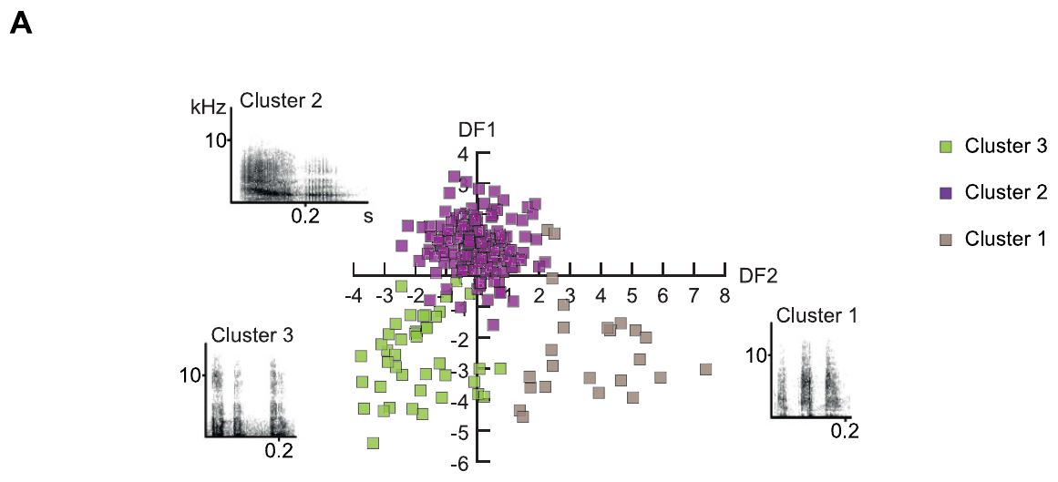
Male alarms have their own acoustic organization
Researchers analyzed male and female calls on separate tracks because the two sexes produced quite different structures. In East African males, Price and colleagues found three clusters, while females had four. The male groups varied in how their elements repeat and in how energy spreads across frequency.
The male spectrograms use second and kHz scales, with sounds shown against 0.2 s intervals. One group contained many short high-frequency elements. Another held fewer, longer elements, and a third had low-frequency components. Their links to predator contexts varied in how exclusive they were.
Sex-specific organization makes a recording from one caller a poor stand-in for the whole alarm repertoire. Body characteristics, vocal mechanics and contextual usage are possible contributors to the difference. Each of these explanations predicts a different pattern across callers.
Price et al. (2015), Fig. 2A. Acoustic clusters of male predator calls.
Price et al. (2015)
20
Notes:
• Male and female recordings were analyzed separately because their acoustic structures differed substantially. In East African males, Price and colleagues identified three clusters rather than the four-cluster female solution. The male categories differed in repeated-element pattern and spectral distribution.
• The male spectrograms retain second and kHz scales, with representative sounds displayed against 0.2 s intervals. One group contained many short high-frequency elements; another contained fewer longer elements; a third had low-frequency components. Their associations with predator contexts were not equally exclusive.
• Sex-specific acoustic organization cautions against treating a recording from one caller as the universal alarm template. The analysis concerns measured repertoire structure and does not identify the anatomical origin of sex differences. Body characteristics, vocal mechanics and contextual usage remain distinct possible contributors.
References:
Tabitha Price, Philip Wadewitz, Dorothy Cheney, Robert Seyfarth, Kurt Hammerschmidt, Julia Fischer (2015). Vervets revisited: A quantitative analysis of alarm call structure and context specificity. Scientific Reports 5(1):13220. https://doi.org/10.1038/srep13220
Figure: Price et al. (2015), Fig. 2A. Acoustic clusters of male predator calls.
Figure source: https://doi.org/10.1038/srep13220

Slide 27
Male snake and eagle calls partially overlap
Acoustic overlap happens when distinct eliciting situations yield similar spans of measured call features. In male data, some low-frequency calls occurred during both eagle and snake encounters. The published clusters therefore matched the three predator categories imperfectly, with some calls appearing in two of them.
Male elements averaged 76.5 ms in aerial calls, 61.1 ms in snake calls and 112.0 ms in terrestrial calls. Male peak frequencies averaged 1090 Hz, 1639 Hz and 1904 Hz, in the same order. Duration and frequency together describe these contrasts.
Average values differ across contexts, but individual calls can fall into the overlap. A listener may integrate several features with environmental information. Playback experiments with particular recipients show how that ambiguity shapes defensive behavior in a given setting.
Price et al. (2015), Fig. 2A. Acoustic clusters of male predator calls.
Price et al. (2015)
21
Notes:
• **Acoustic overlap** occurs when different eliciting contexts produce similar ranges of measured call features. In the male data, some low-frequency calls occurred during both eagle and snake encounters. The published clusters therefore did not correspond perfectly to three mutually exclusive predator categories.
• Mean male element duration was 76.5 ms for aerial calls, 61.1 ms for snake calls and 112.0 ms for terrestrial calls. Male peak frequencies averaged 1090 Hz, 1639 Hz and 1904 Hz respectively. Duration and frequency jointly described these contrasts.
• Differences in average values do not make every individual call unambiguous. A listener may integrate several features and additional environmental information. These recordings establish distributions of production, while recipient-specific playback experiments are needed to determine how ambiguity affects defensive behavior in a particular setting.
References:
Tabitha Price, Philip Wadewitz, Dorothy Cheney, Robert Seyfarth, Kurt Hammerschmidt, Julia Fischer (2015). Vervets revisited: A quantitative analysis of alarm call structure and context specificity. Scientific Reports 5(1):13220. https://doi.org/10.1038/srep13220
Figure: Price et al. (2015), Fig. 2A. Acoustic clusters of male predator calls.
Figure source: https://doi.org/10.1038/srep13220

Slide 28
Male snake and eagle calls share frequencies
In the male recordings, some low-frequency calls appeared in both eagle and snake encounters. The three published clusters lined up only roughly with the predator categories. Some calls appeared in two categories at once. Some calls were therefore shared across predator contexts.
Male element durations averaged 76.5 ms in aerial calls, 61.1 ms in snake calls and 112.0 ms in terrestrial calls. The corresponding peak frequencies were 1090 Hz, 1639 Hz and 1904 Hz, so the two measures separate the contexts together.
Individual calls can land inside the shared range even when the averages differ. Listeners may weigh several features together, along with other environmental cues, when they respond. Averages alone leave some calls in the overlap. Averages describe the recordings, not each individual call.
Price et al. (2015), Fig. 2A. Acoustic clusters of male predator calls.
Price et al. (2015)
21a
Notes:
• Male snake and eagle calls share frequencies.
• Overlap.
– Some low-frequency calls occurred in eagle and snake encounters.
– The clusters matched the predator categories imperfectly.
– Similar feature ranges arise in different contexts.
• Duration.
– Aerial male elements averaged 76.5 ms.
– Snake elements averaged 61.1 ms.
– Terrestrial elements averaged 112.0 ms.
• Frequency.
– Male peak frequencies averaged 1090 Hz for aerial calls.
– Snake calls averaged 1639 Hz.
– Terrestrial calls averaged 1904 Hz.
• Meaning.
– Averages differ across the contexts.
– Individual calls can fall inside the overlap.
– Listeners may combine several features with environmental information.
• Cluster structure.
– Male recordings were analyzed separately from female recordings.
– The male solution had three clusters, while the female solution had four.
– Each cluster's association with predator contexts was not equally exclusive.
– The male clusters differed in repeated-element pattern and in spectral distribution.
– Low-frequency components marked the third male cluster.
– Averages describe the recordings rather than each individual call.
– Cluster boundaries come from the measured features.
References:
Tabitha Price, Philip Wadewitz, Dorothy Cheney, Robert Seyfarth, Kurt Hammerschmidt, Julia Fischer (2015). Vervets revisited: A quantitative analysis of alarm call structure and context specificity. Scientific Reports 5(1):13220. https://doi.org/10.1038/srep13220

Slide 29
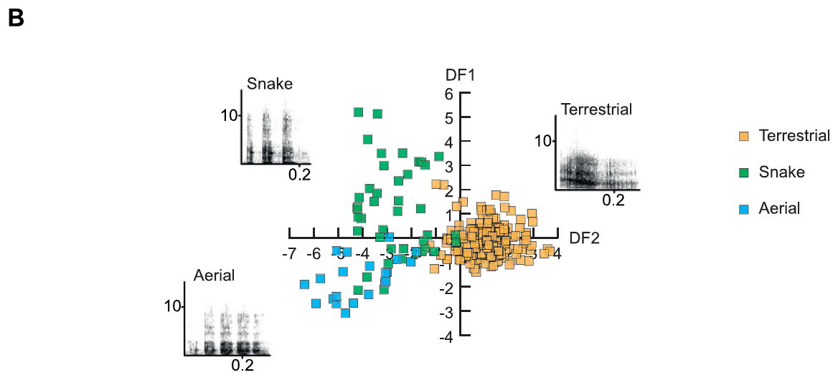
Spectral bandwidth varies across male alarm contexts
Frequency range is the span of frequencies present in a measured call element. Price and colleagues set this measure beside temporal organization and energy distribution in male alarms. The recorded calls varied by context along several dimensions at once.
Mean frequency ranges were 1832 Hz for aerial calls, 4069 Hz for snake calls and 3794 Hz for terrestrial calls. The spectrograms keep frequency and time scales, so the spectral differences can be related to the temporal pattern of each call.
Frequency range is a physical property of the sound, measured the same way in every context. Snake and terrestrial calls had similar ranges, and both were broader than aerial calls. The measure captures the sound itself, so any link to threat level must come from behavior.
Price et al. (2015), Fig. 2B. Male alarm calls grouped by predator context.
Price et al. (2015)
22
Notes:
• **Frequency range** describes the span of acoustic frequencies represented in a measured call element. Price and colleagues compared this measure with temporal organization and energy distribution in male alarms. Their recorded calls differed by context across several dimensions rather than one isolated cue.
• Reported mean frequency ranges were 1832 Hz for aerial calls, 4069 Hz for snake calls and 3794 Hz for terrestrial calls. The original spectrograms retain frequency and time scales, allowing these broad spectral differences to be related to their temporal pattern.
• A broader range does not by itself mean greater threat intensity or a different semantic category. It is a physical feature of the sound. The study does not establish how auditory neurons weight bandwidth relative to other features, nor whether the recipient’s escape decision depends on this measure alone.
References:
Tabitha Price, Philip Wadewitz, Dorothy Cheney, Robert Seyfarth, Kurt Hammerschmidt, Julia Fischer (2015). Vervets revisited: A quantitative analysis of alarm call structure and context specificity. Scientific Reports 5(1):13220. https://doi.org/10.1038/srep13220
Figure: Price et al. (2015), Fig. 2B. Male alarm calls grouped by predator context.
Figure source: https://doi.org/10.1038/srep13220

Slide 30
Classifier separation is not a listener experiment
An acoustic classifier assigns recordings to groups on the basis of measured features. Price and colleagues evaluated how well predator context could be separated in male calls, and they added checks that reduced the chance that caller identity alone explained the result. This analysis of recordings differs from a playback test.
Terrestrial-associated male calls separated more clearly from the others. Some snake and aerial recordings occupied overlapping parts of acoustic space. Terrestrial calls therefore form the clearest group among these male recordings. The spectrograms use 0.2 s scales and kHz frequency axes.
A classifier's success measures the information present in the recordings under the chosen measurements. Behavioral responses and neural recordings address the later stages that link acoustic information to an inferred external event. Each stage uses a different measurement, so each answers a separate question.
Price et al. (2015), Fig. 2B. Male alarm calls grouped by predator context.
Price et al. (2015)
23
Notes:
• An **acoustic classifier** assigns recordings to groups using measured features. Price and colleagues evaluated predator-context separation in male calls using acoustic measurements, with checks that reduced the possibility that caller identity alone explained the result. This is an analysis of recordings, not a playback test.
• The figure represents calls associated with aerial, snake and terrestrial encounters. Source spectrograms have 0.2 s scales and frequency axes in kHz. Terrestrial-associated male calls separated more clearly, while some snake and aerial recordings occupied overlapping portions of acoustic space.
• A computer’s ability to classify calls establishes available information under the chosen measurements. It does not prove that a monkey extracts the same features or recognizes identical categories. Behavioral responses and neural recordings address different stages between acoustic information and an inferred external event.
References:
Tabitha Price, Philip Wadewitz, Dorothy Cheney, Robert Seyfarth, Kurt Hammerschmidt, Julia Fischer (2015). Vervets revisited: A quantitative analysis of alarm call structure and context specificity. Scientific Reports 5(1):13220. https://doi.org/10.1038/srep13220
Figure: Price et al. (2015), Fig. 2B. Male alarm calls grouped by predator context.
Figure source: https://doi.org/10.1038/srep13220

Slide 31
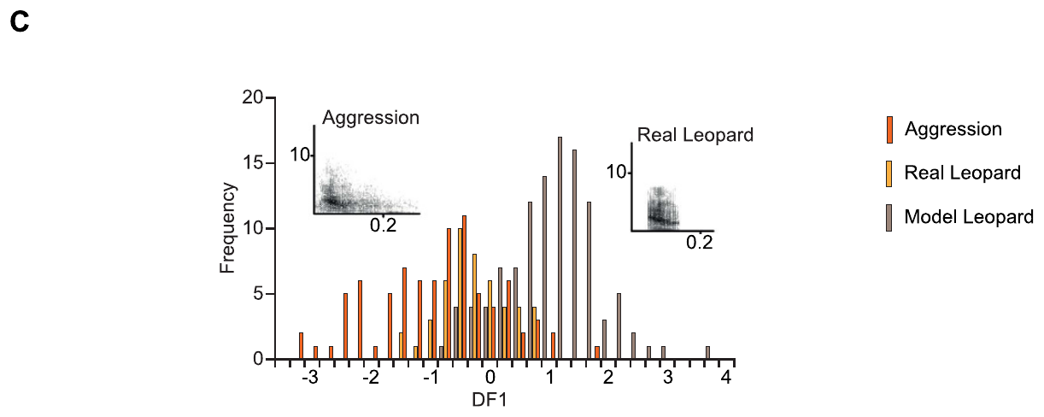
Male barks also occur during social conflict
Barks are a male call form associated with terrestrial threats and also with antagonistic interactions. Price and colleagues analyzed South African recordings made during actual leopard encounters, leopard-model presentations and social aggression. These contexts gave overlapping acoustic distributions.
Calls to real leopards resembled aggressive barks more closely than calls elicited by leopard models did, within the available recordings. Acoustic scores were summarized as a distribution for each context, shown against a 0.2 s reference scale. The leopard-model calls therefore matched the social barks less closely.
A bark can signal a social state as well as a predator, and recipients can use it as information about either. Predator-linked meaning therefore accounts for part of how this call form is used. Predator and social uses share one acoustic form, so the form serves both meanings.
Price et al. (2015), Fig. 2C. South African male barks to real leopards, models and aggression.
Price et al. (2015)
24
Notes:
• **Barks** are a male call form associated with terrestrial threats but also with antagonistic interactions. Price and colleagues examined South African recordings from real leopard encounters, leopard-model presentations and social aggression. These contexts produced overlapping acoustic distributions.
• The source pairs representative waveforms’ spectral patterns with a distribution of acoustic scores. The spectrograms retain a 0.2 s reference scale. Calls to real leopards were more similar to aggressive barks than calls elicited by leopard models were, within the available recordings.
• A bark therefore does not guarantee that a leopard is present. Recipients can still use it as information about a relevant event or state. The distinction matters for claims of production specificity: an exclusively predator-linked interpretation would omit naturally occurring social uses of the same general call form.
References:
Tabitha Price, Philip Wadewitz, Dorothy Cheney, Robert Seyfarth, Kurt Hammerschmidt, Julia Fischer (2015). Vervets revisited: A quantitative analysis of alarm call structure and context specificity. Scientific Reports 5(1):13220. https://doi.org/10.1038/srep13220
Figure: Price et al. (2015), Fig. 2C. South African male barks to real leopards, models and aggression.
Figure source: https://doi.org/10.1038/srep13220

Slide 32
Male barks occur in leopard and social contexts
Male barks appear in two very different settings, leopard threats and social conflict. Price and colleagues compared real leopard encounters, leopard-model presentations and aggression among males. Each context produced its own acoustic distribution in the analysis.
Acoustic scores for each context form their own distribution, displayed here on a 0.2 s reference scale. The calls from real leopard encounters sit closer to the aggressive barks than the calls from models do. Those distributions overlap in the middle, where the same call form appears in both settings.
The same call form therefore carries information about a social state, not only about a predator. Recipients can use it to learn about either situation. Its meaning therefore depends on the situation in which it is heard. Predator-linked uses are one part of that broader pattern.
Price et al. (2015), Fig. 2C. South African male barks to real leopards, models and aggression.
Price et al. (2015)
24a
Notes:
• Male barks occur in leopard and social contexts.
• Barks.
– Barks are associated with terrestrial threats.
– They also occur in antagonistic social interactions.
– The same general call form appears in both settings.
• Recordings.
– Real leopard encounters were analyzed.
– Leopard-model presentations were included.
– Social aggression recordings were analyzed in the same study.
• Similarity.
– Calls to real leopards resembled aggressive barks.
– Calls elicited by leopard models were less similar.
– The comparison used the available recordings.
• Meaning.
– A bark can signal a social state.
– Recipients can use the bark as information about either meaning.
– Production specificity must account for this social use.
• Real and model encounters.
– Calls to real leopards came from actual encounters with the predator.
– Calls elicited by leopard models came from presentations of a model.
– Social aggression supplied a third context for the same call form.
– The South African recordings were compared across the three contexts.
– Spectrograms in the source keep a 0.2 s reference scale for all three.
References:
Tabitha Price, Philip Wadewitz, Dorothy Cheney, Robert Seyfarth, Kurt Hammerschmidt, Julia Fischer (2015). Vervets revisited: A quantitative analysis of alarm call structure and context specificity. Scientific Reports 5(1):13220. https://doi.org/10.1038/srep13220

Slide 33
External events and caller state can both shape calls
Affective state describes an animal's emotional or motivational condition, and cognitive appraisal describes its evaluation of a situation. Price and colleagues proposed that both could shape call structure and use, since acoustically similar male barks occurred with predators and in social aggression.
The recorded distributions contrast real leopard encounters, leopard models and aggressive encounters, with spectrograms on a 0.2 s timescale. The acoustic overlap is the measured finding. A shared internal state that links those contexts is a plausible explanation, suggested by that overlap.
Information about an external event and information about internal state can both appear in one call. Identifying the neurotransmitter, receptor or ion channel behind either contribution would require direct measurements in the callers.
Price et al. (2015), Fig. 2C. South African male barks to real leopards, models and aggression.
Price et al. (2015)
25
Notes:
• **Affective state** refers to an animal’s emotional or motivational condition. **Cognitive appraisal** concerns its evaluation of a situation. Price and colleagues proposed that both could contribute to call structure and use, because acoustically similar male barks occurred with predators and social aggression.
• The recorded distributions compare real leopard, model leopard and aggressive encounters; accompanying spectrograms preserve a 0.2 s timescale. Acoustic overlap is the measured finding. A shared internal state linking those contexts is a possible explanation, not something directly recorded in the callers.
• Information about an external event and information about internal state need not be mutually exclusive. The study does not identify a neurotransmitter, receptor or ion channel mediating either contribution. A molecular mechanism cannot be inferred from call similarity or from the recipient’s response alone.
References:
Tabitha Price, Philip Wadewitz, Dorothy Cheney, Robert Seyfarth, Kurt Hammerschmidt, Julia Fischer (2015). Vervets revisited: A quantitative analysis of alarm call structure and context specificity. Scientific Reports 5(1):13220. https://doi.org/10.1038/srep13220
Figure: Price et al. (2015), Fig. 2C. South African male barks to real leopards, models and aggression.
Figure source: https://doi.org/10.1038/srep13220

Slide 34
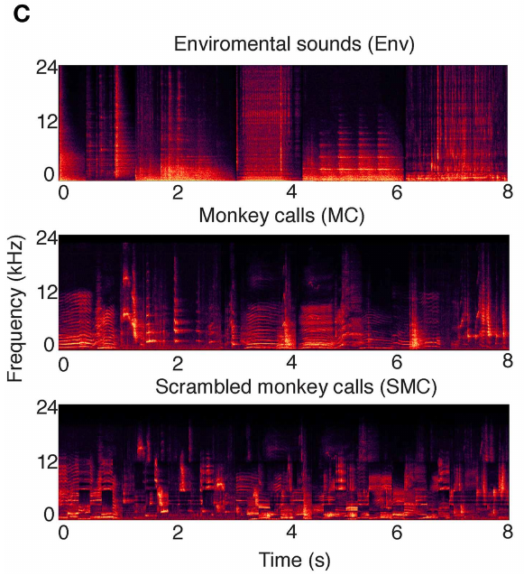
Sound controls isolate features of vocal signals
Conspecific vocalizations are calls produced by members of the listener's own species. Ortiz-Rios and colleagues tested rhesus macaque calls against environmental sounds and scrambled calls during functional MRI. These experiments in macaques supply comparative neural evidence, drawn from a species other than vervets.
Stimuli were grouped into 8 s sequences and played at roughly 80 dB sound pressure level. Scrambling shuffled 200 ms segments across time and frequency, which kept much of each segment's local structure. Environmental sounds provided a second class of complex natural sounds.
Comparing these conditions tests whether activation reflects hearing complex sound or sensitivity to intact vocal patterns. The responses concern macaque auditory processing, so a link to a vervet alarm-decoding circuit is a separate step, and that circuit would need its own measurements.
Ortiz-Rios et al. (2015), Fig. 1C. Environmental sounds, monkey calls and scrambled-call spectrograms.
Ortiz-Rios et al. (2015)
26
Notes:
• **Conspecific vocalizations** are calls produced by members of the listener’s own species. Ortiz-Rios and colleagues compared rhesus macaque calls with environmental sounds and scrambled calls during functional magnetic resonance imaging. These macaque experiments provide comparative neural evidence rather than direct recordings from vervets.
• The stimuli were arranged into 8 s sequences and presented at approximately 80 dB sound pressure level. Scrambling rearranged 200 ms sound segments across time and frequency while preserving substantial local acoustic structure. Environmental sounds supplied another class of complex natural sounds.
• Comparing these conditions addresses whether activation reflects hearing complex sound or sensitivity to intact vocal patterns. None of the conditions tested vervet predator meanings. The measured responses concern macaque auditory processing, so a homology claim must remain separate from an identified vervet alarm-decoding circuit.
References:
Michael Ortiz-Rios, Paweł Kuśmierek, Iain DeWitt, Denis Archakov, Frederico A. C. Azevedo, Mikko Sams, Iiro P. Jääskeläinen, Georgios A. Keliris, Josef P. Rauschecker (2015). Functional MRI of the vocalization-processing network in the macaque brain. Frontiers in Neuroscience 9:113. https://doi.org/10.3389/fnins.2015.00113
Figure: Ortiz-Rios et al. (2015), Fig. 1C. Environmental sounds, monkey calls and scrambled-call spectrograms.
Figure source: https://doi.org/10.3389/fnins.2015.00113

Slide 35
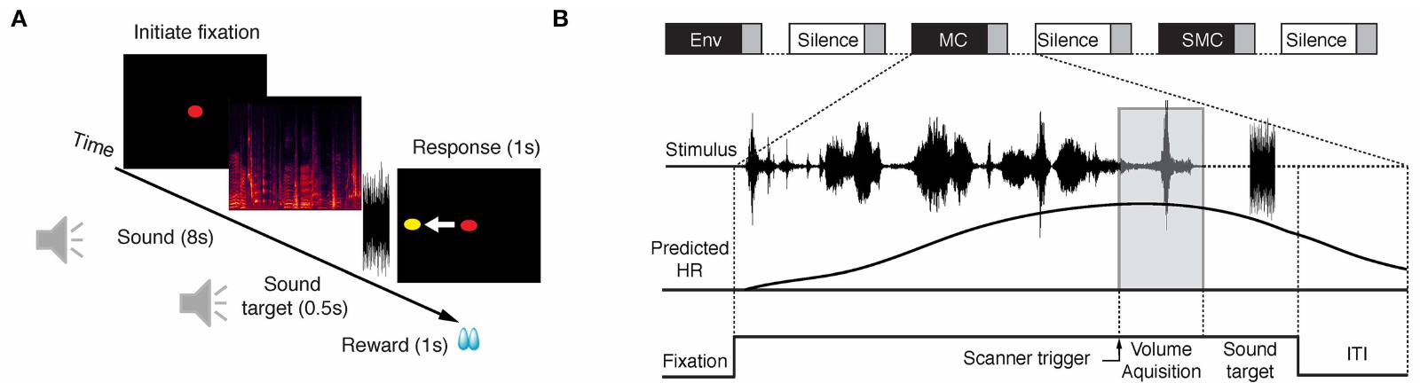
Sparse MRI sampling separates sound from scanner noise
Functional MRI tracks blood-oxygen changes rather than the firing of individual neurons. The scanner itself makes noise. Ortiz-Rios and colleagues used sparse sampling, which places silent intervals between acquisitions and leaves gaps for stimulation, to reduce interference from scanner noise.
Image acquisition began 6 s after each stimulus onset, and each volume took 2.18 s. Sound conditions alternated with silent trials. One macaque performed an auditory task with eye movements, while the other listened during steady fixation, so attention varied between the two animals.
The delayed blood-oxygenation signal localizes sound-sensitive regions. The timing of a single alarm decision is much faster than this signal, so synaptic sign, transmitter release and receptor activation need measurements beyond this imaging approach.
Ortiz-Rios et al. (2015), Fig. 1A–B. Auditory task and sparse MRI acquisition timing.
Ortiz-Rios et al. (2015)
27
Notes:
• **Functional MRI** measures changes associated with blood oxygenation rather than individual neuronal spikes. Scanner operation itself generates sound. Ortiz-Rios and colleagues used **sparse sampling**, leaving intervals for acoustic stimulation before acquiring an image volume, to reduce interference from scanner noise.
• Acquisition began 6 s after stimulus onset; each image volume took 2.18 s. Sound conditions alternated with silence trials. One macaque performed an auditory task with eye movements, while another listened during maintained fixation, allowing attention-related differences to remain visible as a limitation.
• The delayed imaging response can localize sound-sensitive regions but cannot resolve the millisecond timing of a particular alarm decision. A blood-oxygenation contrast also does not identify synaptic sign, transmitter release or receptor activation. Those mechanisms require measurements beyond this imaging preparation.
References:
Michael Ortiz-Rios, Paweł Kuśmierek, Iain DeWitt, Denis Archakov, Frederico A. C. Azevedo, Mikko Sams, Iiro P. Jääskeläinen, Georgios A. Keliris, Josef P. Rauschecker (2015). Functional MRI of the vocalization-processing network in the macaque brain. Frontiers in Neuroscience 9:113. https://doi.org/10.3389/fnins.2015.00113
Figure: Ortiz-Rios et al. (2015), Fig. 1A–B. Auditory task and sparse MRI acquisition timing.
Figure source: https://doi.org/10.3389/fnins.2015.00113

Slide 36
Sparse sampling reduces scanner noise
Functional MRI records blood-oxygenation changes that follow neural activity. The scanner is loud, so the stimulus has to be separated from that noise. Sparse sampling places acquisition after a quiet interval, which keeps the stimulus clear of the scanner sound. The stimulus and the scanner noise therefore occupy separate intervals.
Each stimulus was followed by a 6 s delay before the first volume, and every volume lasted 2.18 s. Sound and silence trials alternated, so each response had a silent baseline in the same session. Acquisition followed the stimulus by a fixed interval.
Sparse sampling makes the auditory response measurable in the first place. Localization is the strength of this method, while the timing of a single decision and synaptic detail require other measurements. The strength of the method lies in tracing where sound-driven activity appears.
Ortiz-Rios et al. (2015), Fig. 1A–B. Auditory task and sparse MRI acquisition timing.
Ortiz-Rios et al. (2015)
27a
Notes:
• Sparse sampling reduces scanner noise.
• Signal.
– Functional MRI tracks changes in blood oxygenation.
– The signal is not a spike-level measure.
– Blood oxygenation follows neural activity with a delay.
• Sampling.
– Quiet intervals precede each image volume.
– Stimulation occurs in the gaps between acquisitions.
– The gaps reduce interference from the scanner.
• Timing.
– Acquisition began 6 s after stimulus onset.
– Each image volume took 2.18 s.
– Sound and silence trials alternated.
• Attention.
– One macaque performed an auditory task with eye movements.
– The other listened during maintained fixation.
– Attention therefore differed between the two animals.
• Meaning.
– The signal localizes sound-sensitive regions.
– Synaptic detail needs other methods.
– Sparse sampling makes the auditory response measurable.
• Silence trials.
– Each sound condition alternated with silence trials.
– Silence provides the baseline for each measured response.
– Sparse sampling was chosen to reduce interference from the scanner.
– Each image volume followed a stimulus interval, so the sound and the acquisition were kept apart.
– The method was applied to awake macaques in the scanner.
References:
Michael Ortiz-Rios, Paweł Kuśmierek, Iain DeWitt, Denis Archakov, Frederico A. C. Azevedo, Mikko Sams, Iiro P. Jääskeläinen, Georgios A. Keliris, Josef P. Rauschecker (2015). Functional MRI of the vocalization-processing network in the macaque brain. Frontiers in Neuroscience 9:113. https://doi.org/10.3389/fnins.2015.00113

Slide 37
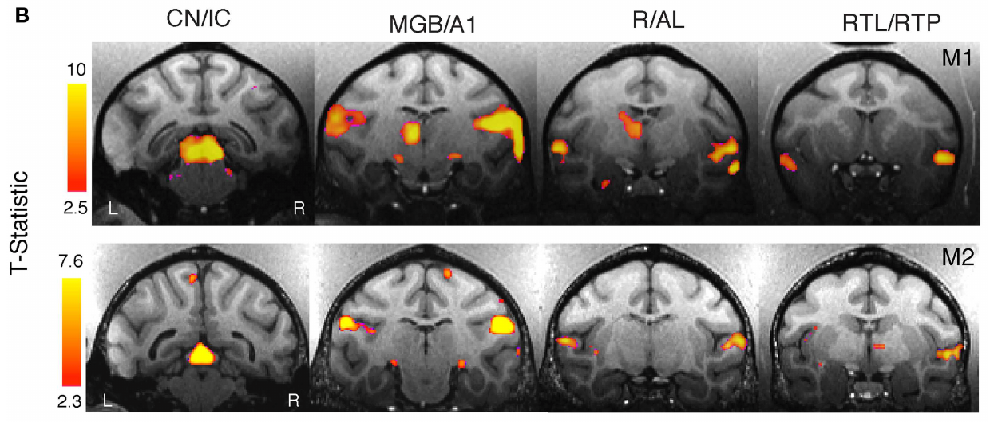
Sound-sensitive regions span the ascending pathway
The ascending auditory pathway carries sound-related signals through brainstem, thalamic and cortical stations. In awake macaques, Ortiz-Rios and colleagues contrasted complex sounds with silence and placed the activation on anatomical MRI sections. The maps covered the inferior colliculus, the medial geniculate and auditory cortex.
The inferior colliculus is a midbrain auditory region, and the medial geniculate nucleus is the auditory relay in the thalamus. Functional images used voxels of 1.5 × 1.5 × 1.9 mm. At that size, each voxel pools signals from many cells and their blood vessels.
These regions responded to several categories of complex sound, so they supply anatomical context for signal reception rather than a call-specific map. Their activity fits a pathway that carries sound toward the cortex. Each region along that route belongs to the reception stage.
Ortiz-Rios et al. (2015), Fig. 2B. Anatomical MRI sections through activated auditory regions.
Ortiz-Rios et al. (2015)
28
Notes:
• The **ascending auditory pathway** carries sound-related signals through brainstem, thalamic and cortical regions. In awake macaques, Ortiz-Rios and colleagues compared complex sounds with silence and localized activation using anatomical MRI sections. The maps include inferior colliculus, medial geniculate and auditory cortex.
• The **inferior colliculus** is a midbrain auditory region, and the **medial geniculate nucleus** is the auditory thalamic relay. Functional images used voxels measuring 1.5 × 1.5 × 1.9 mm. Activation at that scale combines signals from many cells and their associated vasculature.
• These regions responded to several complex-sound categories, not exclusively to meaningful calls. Their participation provides anatomical context for signal reception. The imaging study did not trace a serial synaptic chain from a vervet alarm to an escape response or measure activity in identified defensive motor neurons.
References:
Michael Ortiz-Rios, Paweł Kuśmierek, Iain DeWitt, Denis Archakov, Frederico A. C. Azevedo, Mikko Sams, Iiro P. Jääskeläinen, Georgios A. Keliris, Josef P. Rauschecker (2015). Functional MRI of the vocalization-processing network in the macaque brain. Frontiers in Neuroscience 9:113. https://doi.org/10.3389/fnins.2015.00113
Figure: Ortiz-Rios et al. (2015), Fig. 2B. Anatomical MRI sections through activated auditory regions.
Figure source: https://doi.org/10.3389/fnins.2015.00113

Slide 38
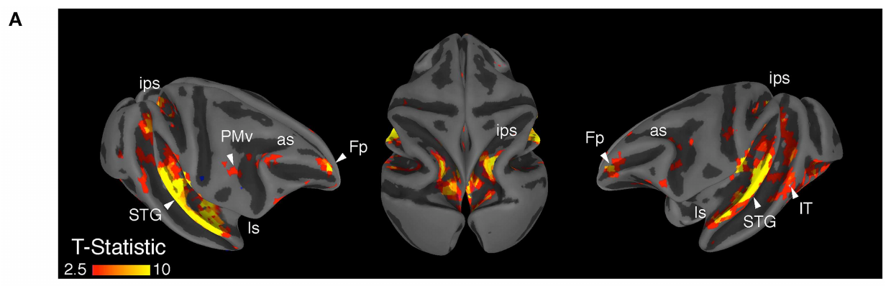
Auditory cortical activation extends beyond primary cortex
Primary auditory cortex, also called A1, is the cortical area that receives heavy ascending auditory input. Belt and parabelt label neighboring auditory cortical areas. Ortiz-Rios and colleagues mapped complex-sound activation onto anatomical surfaces and saw responses across these auditory territories.
The 8 s sound sequences were contrasted with silence, so the broad activation reflects auditory stimulation in general. Responses also reached along the superior temporal gyrus, a cortical ridge with auditory and auditory-associated regions.
An anatomical activation map shows the location of a measured response. Each colored region may perform a different computation, and selectivity for intact calls depends on comparisons with matched non-call or scrambled-call controls. The map sets the spatial scope of the response, not its function.
Ortiz-Rios et al. (2015), Fig. 2A. Auditory activation on anatomical cortical surfaces.
Ortiz-Rios et al. (2015)
29
Notes:
• **Primary auditory cortex**, also called A1, is a cortical region receiving substantial ascending auditory input. **Belt** and **parabelt** designate adjoining auditory cortical regions. Ortiz-Rios and colleagues mapped complex-sound activation onto anatomical surfaces and found responses across these auditory territories.
• The comparison used 8 s sound sequences and silence trials, so widespread activation reflects auditory stimulation before any stronger claim of vocal selectivity. Responses also extended along the superior temporal gyrus, a cortical ridge containing auditory and auditory-associated areas.
• An anatomical activation map identifies where a measured response occurs. It does not prove that each colored region performs the same computation or that activation propagates in a fixed order. Selectivity for intact calls requires additional comparisons against appropriately matched non-call or scrambled-call controls.
References:
Michael Ortiz-Rios, Paweł Kuśmierek, Iain DeWitt, Denis Archakov, Frederico A. C. Azevedo, Mikko Sams, Iiro P. Jääskeläinen, Georgios A. Keliris, Josef P. Rauschecker (2015). Functional MRI of the vocalization-processing network in the macaque brain. Frontiers in Neuroscience 9:113. https://doi.org/10.3389/fnins.2015.00113
Figure: Ortiz-Rios et al. (2015), Fig. 2A. Auditory activation on anatomical cortical surfaces.
Figure source: https://doi.org/10.3389/fnins.2015.00113

Slide 39
Hemispheric response differences depend on the contrast
Hemispheric lateralization is an unequal contribution or measured response from the two sides of the brain. Ortiz-Rios and colleagues compared auditory activation in both macaque hemispheres, using anatomical sections and regional blood-oxygenation responses instead of a single visible patch.
Both animals responded more strongly to complex sounds in the right hemisphere under these conditions. The sounds were calibrated to roughly 80 dB, and silence trials supplied the baseline. The pattern held for the tested sound set and imaging conditions.
The larger right-hemisphere response reflects this sound set and these imaging conditions. Attention differed between the two animals, and each contrast emphasizes a different part of auditory processing. Regional response size and behavioral necessity are separate empirical questions, each measured in its own way.
Ortiz-Rios et al. (2015), Fig. 2B. Anatomical MRI sections through activated auditory regions.
Ortiz-Rios et al. (2015)
30
Notes:
• **Hemispheric lateralization** is an unequal contribution or measured response between the two sides of the brain. Ortiz-Rios and colleagues compared auditory activation in both macaque hemispheres using anatomical sections and regional blood-oxygenation responses rather than inferring dominance from one visible activation patch.
• Both animals had a larger response to complex sounds in the right hemisphere in this preparation. The sounds were calibrated to approximately 80 dB sound pressure level, and silence trials provided the baseline. The observation applied to the tested sound set and imaging conditions.
• This difference is not evidence that the right hemisphere alone understands alarms or that a vervet’s semantic decisions have the same lateralization. Attention differed between animals, and contrasts can emphasize different components of processing. Regional response magnitude and behavioral necessity are separate empirical questions.
References:
Michael Ortiz-Rios, Paweł Kuśmierek, Iain DeWitt, Denis Archakov, Frederico A. C. Azevedo, Mikko Sams, Iiro P. Jääskeläinen, Georgios A. Keliris, Josef P. Rauschecker (2015). Functional MRI of the vocalization-processing network in the macaque brain. Frontiers in Neuroscience 9:113. https://doi.org/10.3389/fnins.2015.00113
Figure: Ortiz-Rios et al. (2015), Fig. 2B. Anatomical MRI sections through activated auditory regions.
Figure source: https://doi.org/10.3389/fnins.2015.00113

Slide 40
The right hemisphere shows the larger response
The two sides of the brain can be compared by anatomical section and by regional blood-oxygenation response. Ortiz-Rios and colleagues did this in both macaque hemispheres, so the result rested on measured responses rather than on one visible patch.
In both animals, complex sounds drove a stronger response on the right side under these conditions. Calibration at about 80 dB sound pressure level set the stimulus strength, and silence provided the baseline for each measured value. Both animals showed the same right-side pattern under this design.
The right-side advantage depends on the sounds and the imaging conditions used. Attention differed between the two animals, so each contrast brings out a different part of auditory processing. Response size and behavioral necessity are separate questions that need separate measures.
Ortiz-Rios et al. (2015), Fig. 2B. Anatomical MRI sections through activated auditory regions.
Ortiz-Rios et al. (2015)
30a
Notes:
• The right hemisphere shows the larger response.
• Lateralization.
– Lateralization is an unequal response between the two sides.
– Both hemispheres were compared in each macaque.
– The comparison used anatomical sections.
• Measures.
– Regional blood-oxygenation responses were measured.
– A single visible activation patch was not the basis for dominance.
– Each side was assessed by its measured response.
• Result.
– Both animals responded more strongly on the right to complex sounds.
– The sounds were calibrated to about 80 dB.
– Silence trials provided the baseline for each comparison.
• Meaning.
– The response pattern depends on the sound set and imaging conditions.
– Attention differed between the two animals.
– Each contrast emphasizes different components of processing.
• Anatomical sections.
– Anatomical sections show where each measured activation sits.
– Regional blood-oxygenation responses were compared across the two hemispheres.
– Both animals showed the larger right-side response in this preparation.
– The contrast was built from the same complex-sound and silence conditions for both sides.
– The result describes one sound set and one imaging design.
References:
Michael Ortiz-Rios, Paweł Kuśmierek, Iain DeWitt, Denis Archakov, Frederico A. C. Azevedo, Mikko Sams, Iiro P. Jääskeläinen, Georgios A. Keliris, Josef P. Rauschecker (2015). Functional MRI of the vocalization-processing network in the macaque brain. Frontiers in Neuroscience 9:113. https://doi.org/10.3389/fnins.2015.00113

Slide 41
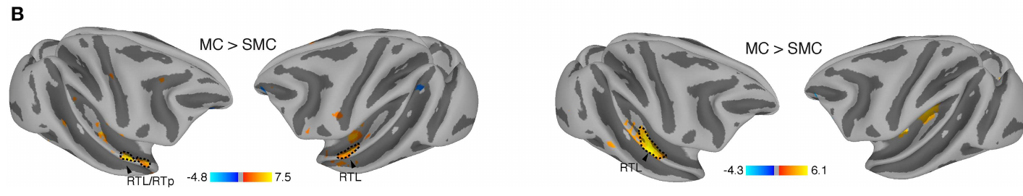
Anterior temporal regions prefer intact calls
The superior temporal gyrus contains auditory-associated cortex, and its anterior portion lies toward the front of the temporal lobe. Ortiz-Rios and colleagues compared intact macaque calls with scrambled versions to find where local acoustic similarity failed to explain the response.
Scrambling assembled 200 ms tiles, each spanning one octave of frequency. An octave is a doubling or halving of frequency, and here it sets the spectral width of each tile. Intact calls evoked stronger responses than scrambled controls in anterior temporal regions, including rostrotemporal areas.
The result indicates sensitivity to organized vocal patterns beyond some preserved local sound features. The responses were recorded in macaques, so they point to processing of vocal organization rather than to a neuron that represents a predator.
Ortiz-Rios et al. (2015), Fig. 3B. Call-versus-scrambled-call activation on anatomical cortical surfaces.
Ortiz-Rios et al. (2015)
31
Notes:
• The **superior temporal gyrus** contains auditory-associated cortex; its anterior portion lies toward the front of the temporal lobe. Ortiz-Rios and colleagues compared intact macaque calls with scrambled versions to ask where local acoustic similarity was insufficient to account for the imaging response.
• Scrambling used 200 ms by one-octave acoustic tiles. An **octave** is a doubling or halving of frequency, here describing the spectral extent of each tile. Intact calls produced stronger responses in anterior temporal regions, including rostrotemporal areas, than these scrambled controls.
• The result supports sensitivity to the organized vocal pattern beyond some preserved local sound features. It does not identify a neuron representing a predator or prove understanding of a call’s referent. These were macaque vocalizations and regional imaging signals, not semantic tests of vervet alarm categories.
References:
Michael Ortiz-Rios, Paweł Kuśmierek, Iain DeWitt, Denis Archakov, Frederico A. C. Azevedo, Mikko Sams, Iiro P. Jääskeläinen, Georgios A. Keliris, Josef P. Rauschecker (2015). Functional MRI of the vocalization-processing network in the macaque brain. Frontiers in Neuroscience 9:113. https://doi.org/10.3389/fnins.2015.00113
Figure: Ortiz-Rios et al. (2015), Fig. 3B. Call-versus-scrambled-call activation on anatomical cortical surfaces.
Figure source: https://doi.org/10.3389/fnins.2015.00113

Slide 42
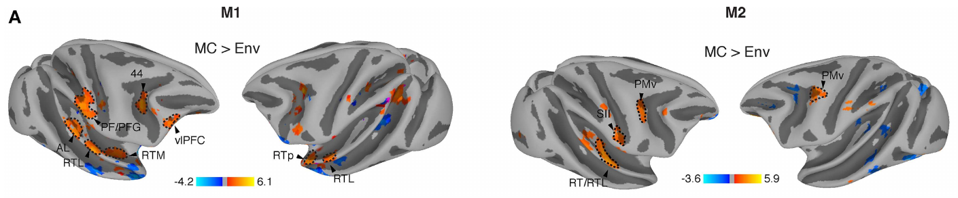
Frontal activation requires careful acoustic controls
Ventrolateral prefrontal cortex is a frontal cortical area, and ventral premotor cortex takes part in sensorimotor processing. Imaging contrasts between calls and environmental sounds produced activation in frontal and parietal cortex as well as in temporal auditory regions.
The environmental sounds were complex natural recordings, but their spectrotemporal patterns were distinct from the calls. Spectrotemporal structure describes how acoustic energy changes across frequency and time together. The 200 ms scrambling control kept more of the calls' local sound properties than it kept of the environmental sounds.
Scrambled calls also activated some frontal and parietal regions. A response to a call can therefore arise from acoustics, task demands or associated processing. Each contrast mixes several sources of activity in the same regions.
Ortiz-Rios et al. (2015), Fig. 3A. Call-versus-environment activation on anatomical cortical surfaces.
Ortiz-Rios et al. (2015)
32
Notes:
• **Ventrolateral prefrontal cortex** is a frontal cortical territory, and **ventral premotor cortex** participates in sensorimotor processing. Macaque imaging contrasts between calls and environmental sounds produced activation in portions of frontal and parietal cortex as well as temporal auditory regions.
• The environmental sounds were complex natural recordings, but their spectrotemporal patterns differed from calls. **Spectrotemporal structure** combines how acoustic energy varies across frequency and time. The authors’ 200 ms scrambling control preserved more of the calls’ local sound properties than environmental sounds did.
• Scrambled calls also activated some frontal and parietal regions, limiting a vocal-meaning interpretation of those contrasts. A response to a call can arise from acoustics, task demands or associated processing. Regional activation therefore does not establish a frontal semantic code or a causal contribution to vervet alarm comprehension.
References:
Michael Ortiz-Rios, Paweł Kuśmierek, Iain DeWitt, Denis Archakov, Frederico A. C. Azevedo, Mikko Sams, Iiro P. Jääskeläinen, Georgios A. Keliris, Josef P. Rauschecker (2015). Functional MRI of the vocalization-processing network in the macaque brain. Frontiers in Neuroscience 9:113. https://doi.org/10.3389/fnins.2015.00113
Figure: Ortiz-Rios et al. (2015), Fig. 3A. Call-versus-environment activation on anatomical cortical surfaces.
Figure source: https://doi.org/10.3389/fnins.2015.00113

Slide 43
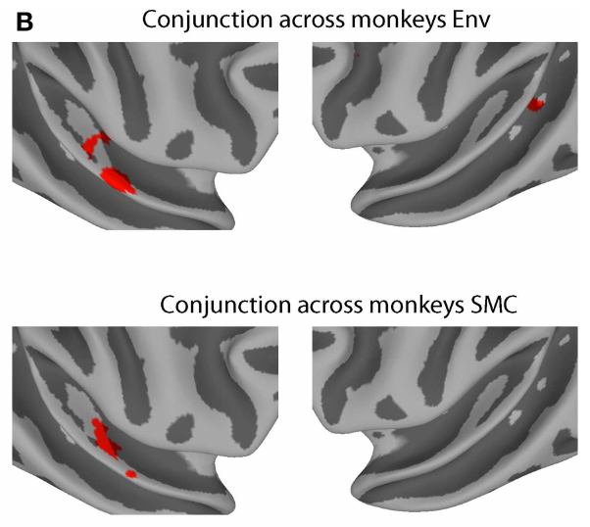
Converging contrasts localize a narrower call preference
A conjunction analysis identifies regions that meet more than one comparison, so a result must hold across several controls. Ortiz-Rios and colleagues combined call-versus-environmental-sound and call-versus-scrambled-call comparisons, then looked for convergence across the macaques.
The strongest shared result involved anterior temporal regions, including lateral rostrotemporal cortex and the rostrotemporal pole. Stimuli were presented as 8 s sequences, with acquisition starting after 6 s. The map shows the blood-oxygenation response that survives both comparisons.
This convergence supports a narrower vocal-processing interpretation than the broader environmental-sound contrast alone provides. Comparative auditory specialization narrows the plausible explanations for how macaque brains process communication sounds. Two independent controls agreeing gives the result more weight than either control alone.
Ortiz-Rios et al. (2015), Fig. 4B. Call-selective anatomical regions shared across animals.
Ortiz-Rios et al. (2015)
33
Notes:
• A **conjunction analysis** identifies regions meeting more than one comparison, rather than accepting a result found with only one control. Ortiz-Rios and colleagues combined call-versus-environmental-sound and call-versus-scrambled-call comparisons, then examined convergence across the macaques.
• The strongest common result involved anterior temporal regions, including lateral rostrotemporal cortex and the rostrotemporal pole. Stimuli were presented as 8 s sequences, with image acquisition beginning after 6 s. The anatomical map localizes the blood-oxygenation response retained across these comparisons.
• This convergence supports a narrower vocal-processing interpretation than the broader environmental-sound contrast alone. It still does not identify a molecular pathway, spike-timing code or predator representation. Comparative auditory specialization can constrain plausible explanations for communication without establishing the neural implementation of functional reference in wild vervets.
References:
Michael Ortiz-Rios, Paweł Kuśmierek, Iain DeWitt, Denis Archakov, Frederico A. C. Azevedo, Mikko Sams, Iiro P. Jääskeläinen, Georgios A. Keliris, Josef P. Rauschecker (2015). Functional MRI of the vocalization-processing network in the macaque brain. Frontiers in Neuroscience 9:113. https://doi.org/10.3389/fnins.2015.00113
Figure: Ortiz-Rios et al. (2015), Fig. 4B. Call-selective anatomical regions shared across animals.
Figure source: https://doi.org/10.3389/fnins.2015.00113

Slide 44
Anterior temporal regions respond to intact calls
Converging results carry more weight than a single comparison. Ortiz-Rios and colleagues combined two contrasts, call versus environmental sound and call versus scrambled call, then searched for regions that responded to both in the macaques.
The shared region sat in the anterior temporal cortex, including lateral rostrotemporal areas and the rostrotemporal pole. Stimuli were 8 s sequences, and acquisition began 6 s in, which set the timing of each measured response. The map then places that response on the anatomy.
Convergence across two independent controls narrows the explanation toward vocal processing. Environmental sounds alone would give a broader picture, which is why the two-control design matters. Each control removes a different alternative explanation.
Ortiz-Rios et al. (2015), Fig. 4B. Call-selective anatomical regions shared across animals.
Ortiz-Rios et al. (2015)
33a
Notes:
• Anterior temporal regions respond to intact calls.
• Analysis.
– A conjunction analysis finds regions shared by several comparisons.
– A result must hold across multiple controls.
– The macaques were examined for convergence.
• Comparisons.
– Calls were tested against environmental sounds.
– Calls were also tested against scrambled calls.
– Each comparison isolates a different aspect of the sounds.
• Result.
– The anterior temporal regions were the strongest shared result.
– The rostrotemporal pole was included in that result.
– Stimuli were 8 s sequences with acquisition beginning after 6 s.
• Anatomy.
– Lateral rostrotemporal cortex was part of the convergence.
– The anatomical map localizes the blood-oxygenation response.
– The response was retained across the comparisons.
• Meaning.
– The convergence points to vocal processing.
– The result narrows the explanations for macaque communication.
– Comparative specialization constrains how macaque brains process calls.
• Scrambling control.
– Scrambling rearranged 200 ms segments across time and frequency.
– The scrambled stimuli kept much of the local acoustic structure.
– Intact calls still produced stronger anterior temporal responses.
References:
Michael Ortiz-Rios, Paweł Kuśmierek, Iain DeWitt, Denis Archakov, Frederico A. C. Azevedo, Mikko Sams, Iiro P. Jääskeläinen, Georgios A. Keliris, Josef P. Rauschecker (2015). Functional MRI of the vocalization-processing network in the macaque brain. Frontiers in Neuroscience 9:113. https://doi.org/10.3389/fnins.2015.00113

Slide 45
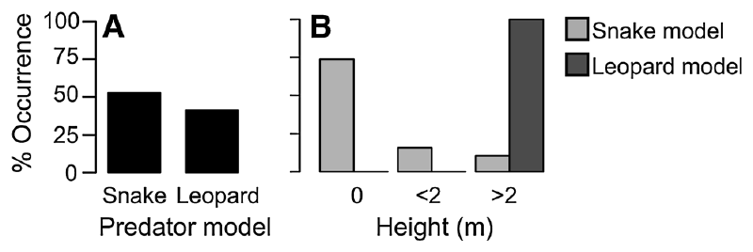
Green monkeys do not copy every vervet response
Chlorocebus sabaeus, the West African green monkey, is closely related to vervets, yet it is a separate species in this study. Price and Fischer presented leopard and snake models in Senegal and filmed the first 10 s of each subject's response to the detected model.
Leopard models elicited more tree climbing than snake models did. Standing bipedally appeared in both threat settings, so it was a shared posture rather than a snake-specific one. The researchers recorded movement and maximum height, which distinguished refuge selection from posture and general inspection.
The model experiment established which behaviors are appropriate for interpreting this population's playback responses. Posture meanings are therefore set within this green monkey population, using the behaviors observed during model encounters. Those measured behaviors then serve as the reference for each playback result.
Price & Fischer (2014), Fig. 1A–B. Responses to snake and leopard models, including tree height.
Price & Fischer (2014)
34
Notes:
• West African **green monkeys**, _Chlorocebus sabaeus_, are close relatives of vervets but a distinct species in this study. Price and Fischer presented leopard and snake models in Senegal and filmed the first 10 s of each subject’s response to the detected model.
• Leopard models elicited higher tree climbing than snake models. Standing bipedally occurred in both threat settings rather than being a uniquely snake-directed response. The researchers recorded movement and maximum height, separating refuge selection from posture and generalized inspection.
• Similar ancestry does not guarantee identical predator-response mappings. The model experiment established behaviors appropriate for interpreting this population’s subsequent playback responses. It does not justify assigning every posture the meaning reported in Amboseli vervets, nor does a model encounter fully reproduce the risk of an attacking predator.
References:
Tabitha Price, Julia Fischer (2014). Meaning attribution in the West African green monkey: influence of call type and context. Animal Cognition 17(2):277-286. https://doi.org/10.1007/s10071-013-0660-9
Figure: Price & Fischer (2014), Fig. 1A–B. Responses to snake and leopard models, including tree height.
Figure source: https://doi.org/10.1007/s10071-013-0660-9

Slide 46
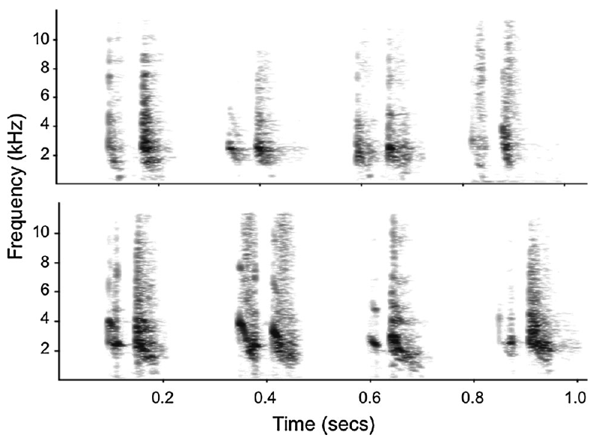
Closely related monkeys use graded predator chirps
Chirps are the call form that the green-monkey predator experiments examined. Both females and juveniles gave chirps in response to leopard and snake models. Price and Fischer built paired playback sequences from recordings of the two eliciting conditions, so the calls were treated as graded variants of one family.
Spectrograms show time in seconds and frequency in kHz. Paired sequences were matched for chirp number, inter-call interval and total sequence duration, with intervals constrained to naturally occurring values. Recordings were normalized before they were broadcast.
These controls rule out explanations based solely on bout length or repeated-call number. Frequency distribution and element duration varied together in the natural recordings, so several dimensions covary with the predator distinction. Graded differences within each chirp stayed available to listeners.
Price & Fischer (2014), Fig. 2. Paired snake and leopard chirp spectrograms.
Price & Fischer (2014)
35
Notes:
• A **chirp** is the call form examined in the green-monkey predator experiments. Females and juveniles produced chirps to both leopard and snake models. Price and Fischer constructed paired playback sequences using recordings from the two eliciting conditions rather than treating them as completely different call families.
• The spectrograms preserve time in seconds and frequency in kHz. Paired sequences were matched for chirp number, inter-call interval and overall sequence duration, with their intervals constrained to naturally occurring values. Recordings were also normalized before experimental broadcasting.
• These controls reduce explanations based solely on bout length or repeated-call number. Graded differences within chirps remained available to listeners. The preparation does not establish that a single acoustic dimension carries the predator distinction; frequency distribution and element duration varied together in the natural recordings.
References:
Tabitha Price, Julia Fischer (2014). Meaning attribution in the West African green monkey: influence of call type and context. Animal Cognition 17(2):277-286. https://doi.org/10.1007/s10071-013-0660-9
Figure: Price & Fischer (2014), Fig. 2. Paired snake and leopard chirp spectrograms.
Figure source: https://doi.org/10.1007/s10071-013-0660-9

Slide 47
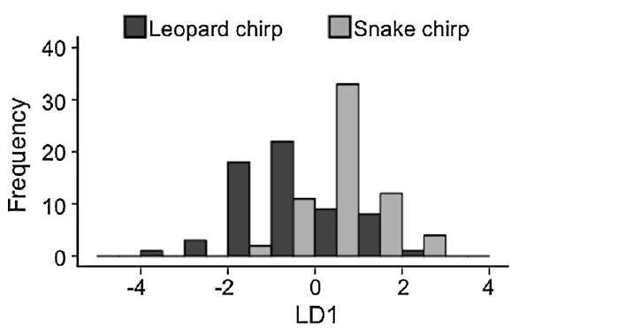
Chirp distributions overlap across predator contexts
Graded acoustic categories can overlap considerably even when their average structures differ. Price and Fischer examined chirps from green monkeys that leopard and snake models had elicited. Duration and an early peak-frequency measure contributed most to separating the recordings.
Chirps linked to leopards lasted longer and showed a higher early peak frequency than chirps linked to snakes. Durations were measured in milliseconds and frequencies in Hz. Their score distributions overlapped, forming a continuum rather than two fully separate groups.
The findings show variation that can be detected physically within one broad call form. How a recipient responds to an intermediate chirp, as a leopard threat, a snake threat or a cue to inspect, depends on reception and decision processes. The acoustic analysis captures the input, not the decision.
Price & Fischer (2014), Fig. 3. Overlapping distributions of snake and leopard chirps.
Price & Fischer (2014)
36
Notes:
• **Graded acoustic categories** can contain considerable overlap even when their average structures differ. Price and Fischer analyzed green-monkey chirps elicited by leopard and snake models. Duration and an early peak-frequency measure contributed strongly to separating the recordings.
• Leopard-associated chirps were longer and had a higher early peak frequency than snake-associated chirps. The source analysis measured duration in milliseconds and frequency in Hz. Its score distributions overlapped rather than producing two completely separated groups of calls.
• The findings support physically detectable variation within one broad call form, not perfect production specificity. Overlap leaves some individual sounds ambiguous. Whether a recipient treats an intermediate chirp as a leopard threat, a snake threat or a reason to inspect depends on reception and decision processes not measured by this acoustic analysis alone.
References:
Tabitha Price, Julia Fischer (2014). Meaning attribution in the West African green monkey: influence of call type and context. Animal Cognition 17(2):277-286. https://doi.org/10.1007/s10071-013-0660-9
Figure: Price & Fischer (2014), Fig. 3. Overlapping distributions of snake and leopard chirps.
Figure source: https://doi.org/10.1007/s10071-013-0660-9

Slide 48
Leopard chirps are longer, with higher peaks
Leopard and snake models each elicited chirps in this green-monkey study, and the chirps were analyzed by context. Duration and an early peak-frequency measure together did most of the work of separating the two groups. The chirps were analyzed as continuous measurements rather than as fixed types.
Chirps given to leopard models lasted longer and reached a higher early peak than those given to snake models. Scores were tabulated in milliseconds and Hz, and their distributions formed a continuum between the two groups. Many individual chirps sat in the middle of that range.
The physical variation is present in the sounds themselves. Whether a listener treats a middle chirp as a leopard threat, a snake threat or a reason to inspect depends on reception and decision processes beyond the acoustic analysis. Physical differences set the input, and the listener's processes set the decision.
Price & Fischer (2014), Fig. 3. Overlapping distributions of snake and leopard chirps.
Price & Fischer (2014)
36a
Notes:
• Leopard chirps are longer, with higher peaks.
• Measures.
– Duration and early peak frequency did most of the separating.
– Both measures were scored for each chirp.
– Durations were in milliseconds and frequencies in Hz.
• Leopard chirps.
– Leopard-associated chirps were longer than snake-associated chirps.
– They had a higher early peak frequency.
– The analysis was run on green-monkey recordings.
• Distributions.
– Scores overlapped across the two contexts.
– The overlap formed a continuum rather than two groups.
– Individual chirps can sit between the two contexts.
• Meaning.
– Physical variation is detectable within one call form.
– Reception determines how a listener responds to intermediate chirps.
– The analysis captures the input rather than the decision.
• Chirp comparison.
– Leopard and snake models elicited chirps from the green-monkey population.
– Duration and early peak frequency contributed most to the separation.
– The two contexts overlapped rather than forming separate groups.
– The early peak frequency is one of the measures used in the score.
– Scores were compared between leopard-associated and snake-associated chirps.
References:
Tabitha Price, Julia Fischer (2014). Meaning attribution in the West African green monkey: influence of call type and context. Animal Cognition 17(2):277-286. https://doi.org/10.1007/s10071-013-0660-9

Slide 49
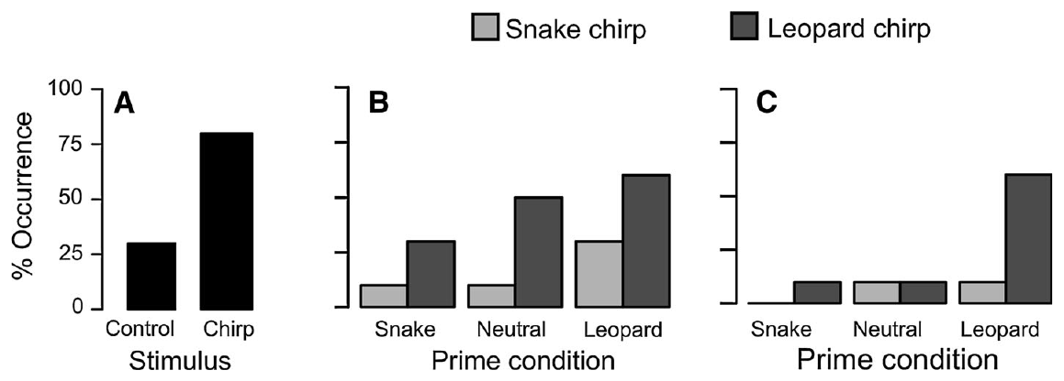
Control bird calls distinguish alarms from broadcasting
An experimental control rules out a competing explanation for an observed response. Price and Fischer broadcast nonpredatory bird calls alongside the green-monkey chirp stimuli. The bird calls served as a control for the playback procedure itself, rather than as another predator-associated monkey signal.
Monkeys responded more often to chirps than to bird sounds. Playback levels stayed in the range of natural calls, 60–85 dB measured at 10 m from the speaker. A different recording sequence was used in each experiment, so no single exemplar was tested repeatedly.
The contrast shows that the monkeys responded to biologically relevant acoustic information, not to any sound from the speaker. Whether the recipient represents a predator, experiences conditioned danger or combines both is a question about interpretation beyond the procedural control.
Price & Fischer (2014), Fig. 4A–C. Playback response, tree climbing and persistence after priming.
Price & Fischer (2014)
37
Notes:
• An **experimental control** excludes a competing explanation for an observed response. Price and Fischer broadcast nonpredatory bird calls alongside green-monkey chirp stimuli. Birds’ calls were a control for the playback procedure itself rather than another predator-associated monkey signal.
• Monkeys responded more often to chirps than to the bird sounds. Playback intensity remained within natural calling levels, 60–85 dB measured at 10 m from the source. A different recording sequence was used for each experiment to avoid repeatedly testing one acoustic exemplar.
• The contrast supports a response to biologically relevant acoustic information rather than to any sound from the speaker. It does not identify whether the recipient represents a predator, experiences conditioned danger or combines both. Those alternatives concern the interpretation of the signal beyond the procedural control.
References:
Tabitha Price, Julia Fischer (2014). Meaning attribution in the West African green monkey: influence of call type and context. Animal Cognition 17(2):277-286. https://doi.org/10.1007/s10071-013-0660-9
Figure: Price & Fischer (2014), Fig. 4A–C. Playback response, tree climbing and persistence after priming.
Figure source: https://doi.org/10.1007/s10071-013-0660-9

Slide 50
Predator priming separates prior evidence from call type
Priming provides relevant information ahead of a later test. Price and Fischer exposed green monkeys to a leopard model, a snake model or no predator model, and then broadcast chirps. The calls were played about 1 h after each model presentation, once alarm calling had stopped.
The design varied the preceding model independently of the original context of each recorded chirp. Chirps linked to leopards more often prompted climbing above 2 m than chirps linked to snakes. The prior model left the immediate response category largely unchanged.
Acoustic cues therefore strongly shaped the early action in this preparation. Information presented an hour earlier can influence later persistence in a different way from the first movement after a call. The first movement is driven mainly by the call's acoustic features.
Price & Fischer (2014), Fig. 4A–C. Playback response, tree climbing and persistence after priming.
Price & Fischer (2014)
38
Notes:
• **Priming** supplies relevant information before a later test. Price and Fischer exposed green monkeys to a leopard model, a snake model or no predator model before broadcasting chirps. The calls were played approximately 1 h after the model presentation, once alarm calling had stopped.
• The experiment independently varied the preceding model and the recorded chirp’s original context. Leopard-associated chirps more often elicited climbing above 2 m than snake-associated chirps. Prior model exposure did not clearly change which immediate response category recipients selected.
• Acoustic cues therefore strongly influenced the early action in this preparation. The absence of a clear immediate priming effect does not establish that prior knowledge was erased. Information presented an hour earlier can influence later persistence differently from the first movement after a call.
References:
Tabitha Price, Julia Fischer (2014). Meaning attribution in the West African green monkey: influence of call type and context. Animal Cognition 17(2):277-286. https://doi.org/10.1007/s10071-013-0660-9
Figure: Price & Fischer (2014), Fig. 4A–C. Playback response, tree climbing and persistence after priming.
Figure source: https://doi.org/10.1007/s10071-013-0660-9

Slide 51
Prior predator evidence changes defensive persistence
Response persistence is the time an action or defensive state continues after it begins. Price and Fischer separated immediate tree climbing from staying in a tree after playback. These two measures capture different consequences of hearing the same broad alarm form.
Subjects stayed in trees longer when leopard-model exposure and leopard-associated chirps both signaled terrestrial danger. The persistence measure recorded whether a subject stayed more than 200 s. The immediate measure recorded climbing above 2 m following the broadcast.
Prior information contributes to sustained risk assessment, even when early action follows mainly from the acoustics. The two measures therefore carry different information about the same call. Early action follows the call's acoustics, while persistence also reflects earlier information.
Price & Fischer (2014), Fig. 4A–C. Playback response, tree climbing and persistence after priming.
Price & Fischer (2014)
39
Notes:
• **Response persistence** is the time an action or defensive state continues after its initiation. Price and Fischer distinguished immediate tree climbing from remaining in a tree after playback. These measures address different consequences of hearing the same broad alarm form.
• Subjects stayed longer in trees when leopard-model exposure and leopard-associated chirps both supported terrestrial danger. The published persistence measure records whether a subject stayed more than 200 s. The immediate response measure instead records climbing above 2 m following the broadcast.
• The evidence is consistent with prior information contributing to sustained risk assessment even where early action mainly follows acoustics. It does not distinguish an updated internal representation from a change in subsequent decision-making. Immediate response and persistence should not be treated as interchangeable measures of meaning attribution.
References:
Tabitha Price, Julia Fischer (2014). Meaning attribution in the West African green monkey: influence of call type and context. Animal Cognition 17(2):277-286. https://doi.org/10.1007/s10071-013-0660-9
Figure: Price & Fischer (2014), Fig. 4A–C. Playback response, tree climbing and persistence after priming.
Figure source: https://doi.org/10.1007/s10071-013-0660-9

Slide 52
Prior predator evidence extends time in trees
Persistence and immediate climbing answer different questions about the same broad alarm. One asks what a monkey does first, and the other asks how long it stays in the tree. Prior evidence can affect the second even when the first follows the acoustics.
When both the leopard model and the leopard chirps signaled terrestrial danger, subjects remained in trees longer. Persistence meant staying more than 200 s, whereas the immediate response meant climbing above 2 m after the broadcast.
Early action follows the call's acoustics, while persistence also reflects earlier information about the threat. The two measures therefore differ in what they reveal about the same call. Each measure adds its own information to that call. Both measures were taken from the same subjects in the same study.
Price & Fischer (2014), Fig. 4A–C. Playback response, tree climbing and persistence after priming.
Price & Fischer (2014)
39a
Notes:
• Prior predator evidence extends time in trees.
• Persistence.
– Persistence is the time a defensive state continues after it begins.
– It was measured against a 200 s threshold.
– Subjects that stayed more than 200 s were counted.
• Immediate.
– Immediate climbing was scored above 2 m.
– It followed the broadcast directly.
– It is a different measure from persistence.
• Priming.
– Leopard-model exposure supported terrestrial danger.
– Leopard-associated chirps supported the same danger.
– Both sources were present together in the persistence condition.
• Meaning.
– Prior evidence shapes sustained risk assessment.
– Early action can follow the acoustics alone.
– The two measures carry different information about one call.
• Measurement.
– Persistence asked whether the subject stayed more than 200 s.
– Immediate climbing was scored above 2 m after the broadcast.
– Both measures were recorded in the same subjects.
– The immediate response and the persistence measure answer different questions about the same alarm.
– Both were tested after the same leopard-associated broadcast.
References:
Tabitha Price, Julia Fischer (2014). Meaning attribution in the West African green monkey: influence of call type and context. Animal Cognition 17(2):277-286. https://doi.org/10.1007/s10071-013-0660-9

Slide 53
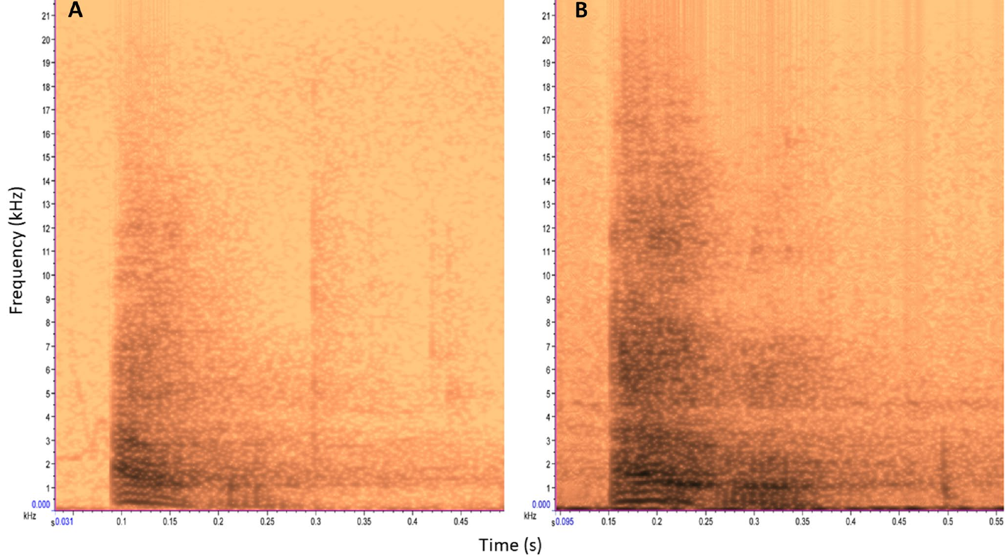
The same male bark can enter contrasting contexts
South African male vervets produce similar alarm barks when a terrestrial predator appears and during conflict between groups. Deshpande and colleagues tested whether recipients used the current social situation to interpret the sound. The stimuli were one predator-associated bark and one intergroup bark from the same adult male.
Each female recipient heard the same assigned recording in both contexts, played at a natural amplitude from a speaker 30–50 m away. This within-recipient design keeps the stimulus fixed while the surrounding intergroup situation changes. Spectrograms show seconds and frequency in Hz.
Holding the recording constant isolates the effect of context from differences between sounds used on different occasions. The experiment tests this call with these receivers under specified field conditions. Each receiver therefore serves as its own comparison across the two situations.
Deshpande et al. (2023), Fig. 1A–B. Male bark exemplars from predator and intergroup encounters.
Deshpande et al. (2023)
40
Notes:
• South African male vervets produce similar **alarm barks** during terrestrial-predator encounters and between-group conflict. Deshpande and colleagues tested whether recipients used current social circumstances to interpret the sound. The stimuli included one predator-associated and one intergroup-associated bark from the same adult male.
• Each female recipient heard the same assigned recording in both contexts, with naturalistic amplitude at a speaker distance of 30–50 m. This within-recipient comparison held the stimulus constant while changing the surrounding intergroup situation. The published spectrograms preserve seconds and frequency in Hz.
• Holding the recording constant separates contextual effects from differences between the sounds used on different occasions. It does not prove that every bark variant is acoustically identical, nor that every receiver uses the same inference. The experiment tests this call and these receivers under specified field conditions.
References:
Adwait Deshpande, Erica van de Waal, Klaus Zuberbühler (2023). Context-dependent alarm responses in wild vervet monkeys. Animal Cognition 26(4):1199-1208. https://doi.org/10.1007/s10071-023-01767-0
Figure: Deshpande et al. (2023), Fig. 1A–B. Male bark exemplars from predator and intergroup encounters.
Figure source: https://doi.org/10.1007/s10071-023-01767-0

Slide 54
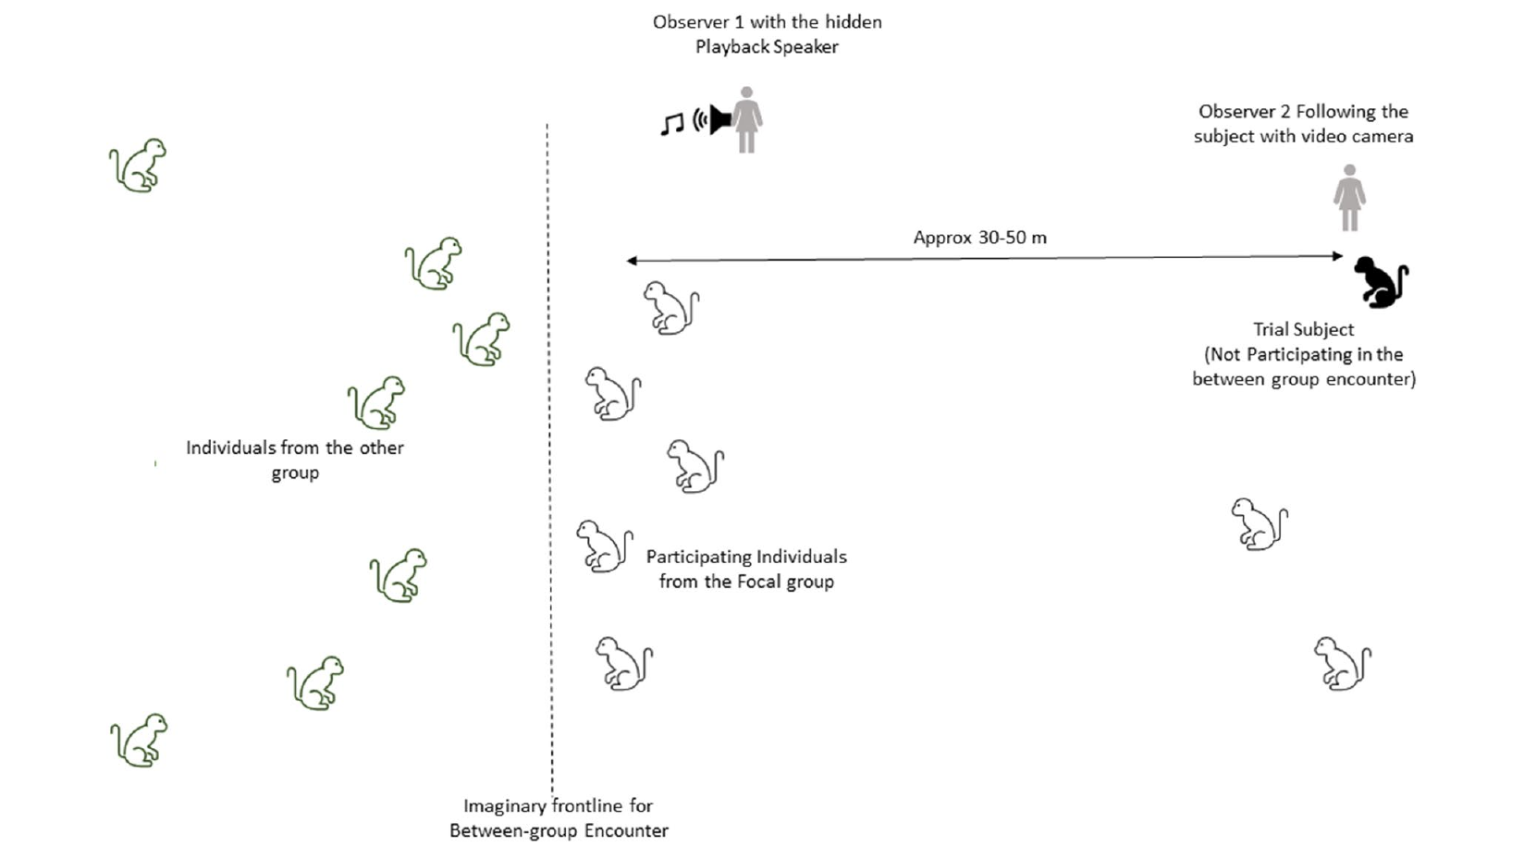
Ongoing social context differs from earlier priming
An intergroup encounter takes place when members of neighboring monkey groups interact. Deshpande and colleagues tested recipients away from the conflict front while the encounter was ongoing. Subjects stayed at least 30 m from the front and were foraging, resting or grooming.
The same recipients were also tested with no intergroup encounter, at least 2 h after the last such event or natural alarm call. Habitat and approximate group spread were matched, and playback came from 30–50 m away. The same playback distance applied in both conditions.
This manipulation supplies immediate contextual information, whereas the earlier model exposure occurred about 1 h before the green-monkey playbacks. Timing and call type were both changed between the two studies, so different outcomes are expected.
Deshpande et al. (2023), Fig. 2. Published spatial arrangement of the intergroup playback experiment.
Deshpande et al. (2023); Price & Fischer (2014)
41
Notes:
• An **intergroup encounter** occurs when members of neighboring monkey groups interact. Deshpande and colleagues tested recipients away from the conflict frontline while the encounter was ongoing. Subjects remained at least 30 m from the frontline and were foraging, resting or grooming.
• The same recipients were tested without an intergroup encounter after at least 2 h without such an event or natural alarm calling. Habitat and approximate group spread were kept similar, and playback came from 30–50 m away. The source’s published field layout specifies these spatial relations.
• This manipulation supplies immediate contextual information, unlike model exposure approximately 1 h before the green-monkey playbacks. Different timing and call types can explain different outcomes without making the studies contradictory. The design does not experimentally assign whether the natural intergroup encounter begins.
References:
Adwait Deshpande, Erica van de Waal, Klaus Zuberbühler (2023). Context-dependent alarm responses in wild vervet monkeys. Animal Cognition 26(4):1199-1208. https://doi.org/10.1007/s10071-023-01767-0
Tabitha Price, Julia Fischer (2014). Meaning attribution in the West African green monkey: influence of call type and context. Animal Cognition 17(2):277-286. https://doi.org/10.1007/s10071-013-0660-9
Figure: Deshpande et al. (2023), Fig. 2. Published spatial arrangement of the intergroup playback experiment.
Figure source: https://doi.org/10.1007/s10071-023-01767-0

Slide 55
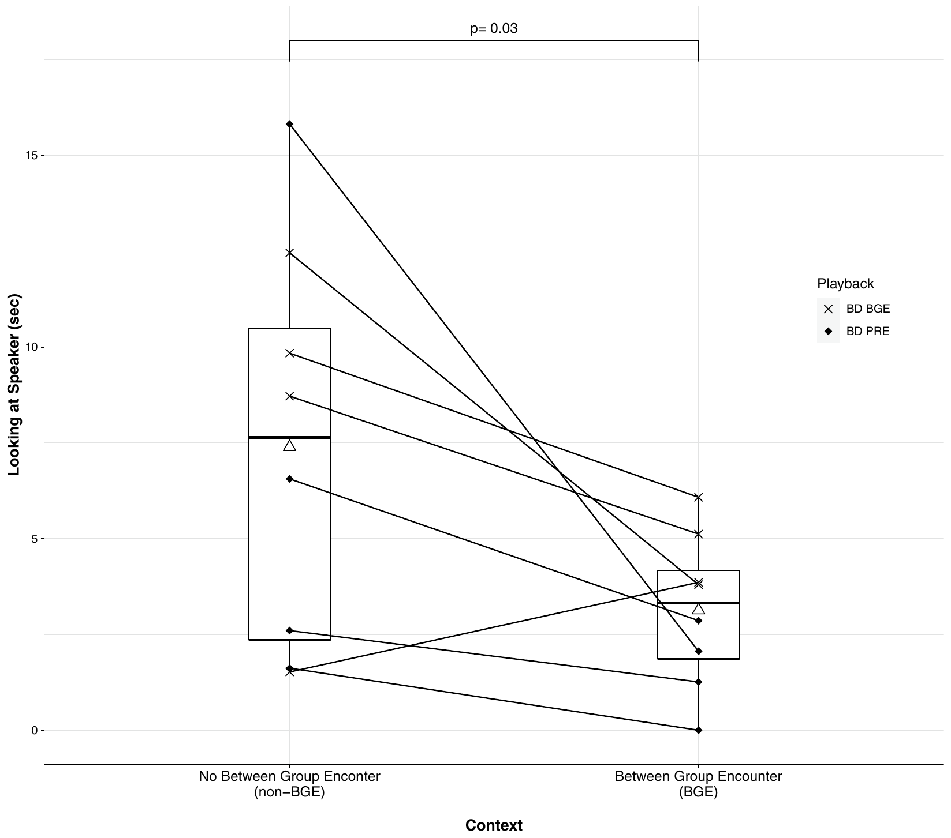
Context alters information seeking toward the caller
Information seeking can involve orienting toward a caller to gather more cues about an alarm's cause. Deshpande and colleagues measured how long recipients looked toward the speaker after hearing the same male bark, both with and without an ongoing intergroup encounter.
Recipients generally looked at the speaker for longer when no intergroup encounter was underway. Looking time was measured in seconds across 10 min of field observation after playback. During an encounter, surrounding social activity already offered a plausible reason for the barking.
The measured effect indicates that acoustic and contextual information are combined. Longer looking is a proposed sign of uncertainty, a reading of the behavior rather than a measured mental state. The change appears within the same bark, which suggests the context itself is doing the work.
Deshpande et al. (2023), Fig. 3. Speaker-directed looking duration with and without an intergroup encounter.
Deshpande et al. (2023)
42
Notes:
• **Information seeking** can involve orienting toward a caller to obtain further cues about an alarm’s cause. Deshpande and colleagues measured how long recipients looked toward the speaker after hearing the same male bark with or without an ongoing intergroup encounter.
• Recipients generally looked toward the speaker longer when no intergroup encounter was occurring. Looking duration was measured in seconds, and the field observations continued for 10 min after playback. During an encounter, the surrounding social activity already supplied a plausible explanation for male barking.
• The measured effect supports integration of acoustic and contextual information. Interpreting longer looking as uncertainty is a proposed explanation rather than a directly measured mental state. The behavior does not establish that recipients imagined a specific hidden predator, and no predator-specific escape response occurred in this experiment.
References:
Adwait Deshpande, Erica van de Waal, Klaus Zuberbühler (2023). Context-dependent alarm responses in wild vervet monkeys. Animal Cognition 26(4):1199-1208. https://doi.org/10.1007/s10071-023-01767-0
Figure: Deshpande et al. (2023), Fig. 3. Speaker-directed looking duration with and without an intergroup encounter.
Figure source: https://doi.org/10.1007/s10071-023-01767-0

Slide 56
Ongoing conflict reduces looking at the caller
Looking toward a caller can help a listener work out what caused an alarm. Deshpande and colleagues played the same male bark to recipients, with and without an intergroup encounter going on, and timed how long each one looked at the speaker.
Looks were longest when the surrounding situation contained no conflict. Times were recorded in seconds across 10 min of field observation. Social activity already explained the barking during an encounter, which may reduce the need to look toward the speaker.
Integrating the bark with the surrounding social context shapes how long recipients keep looking. Reading the longer looks as uncertainty is a proposed interpretation, and it sits apart from any measured mental state. The social setting alone changes between the two conditions.
Deshpande et al. (2023), Fig. 3. Speaker-directed looking duration with and without an intergroup encounter.
Deshpande et al. (2023)
42a
Notes:
• Ongoing conflict reduces looking at the caller.
• Seeking.
– Information seeking involves orienting toward the caller.
– It can yield cues about the cause of an alarm.
– The caller's direction is the target of the look.
• Comparison.
– The same bark was heard with and without an intergroup encounter.
– Looking duration was the measure.
– The bark stayed constant across both conditions.
• Result.
– Looking was longer when no encounter was underway.
– Field observation continued for 10 min after playback.
– Looking time was measured in seconds.
• Context.
– Social activity during an encounter offers an explanation for barking.
– That explanation reduces the need to look toward the caller.
– The reduction is consistent with integration of context.
• Meaning.
– Acoustic and contextual information are integrated.
– Longer looking is a proposed sign of uncertainty.
– The behavior is a reading of the animal's state, not a measured mental state.
• Field observations.
– Observations continued for 10 min after the playback.
– Looking duration was recorded in seconds.
– Recipients looked longer at the speaker when no encounter was underway.
References:
Adwait Deshpande, Erica van de Waal, Klaus Zuberbühler (2023). Context-dependent alarm responses in wild vervet monkeys. Animal Cognition 26(4):1199-1208. https://doi.org/10.1007/s10071-023-01767-0

Slide 57
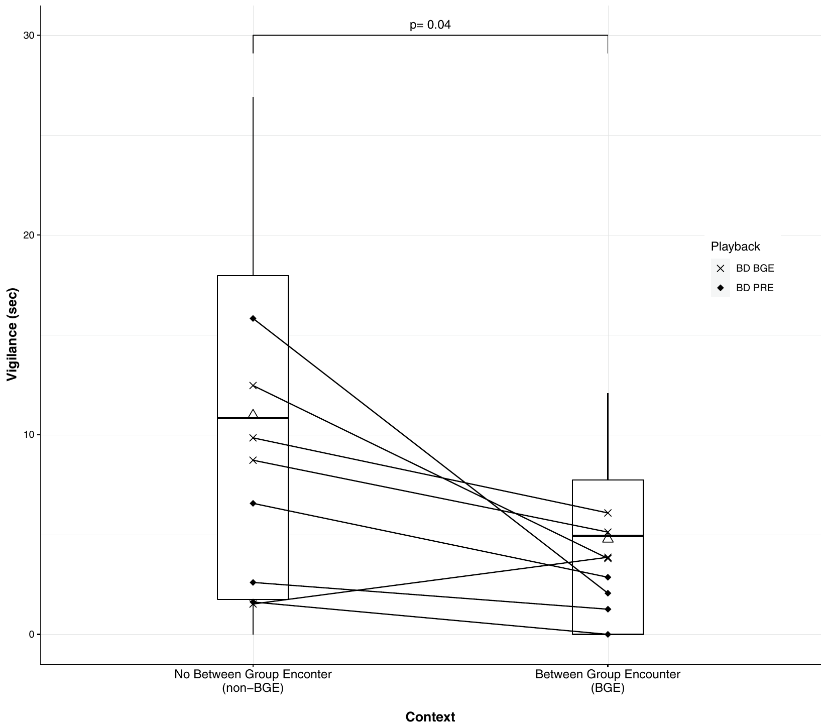
Context changes vigilance without forcing escape
Vigilance is monitoring of the surroundings while maintaining an alert posture. Deshpande and colleagues measured vigilance duration apart from speaker-directed looking, startle and predator-specific escape. Female recipients were more vigilant after barks given outside an intergroup encounter than during one.
Vigilance durations were recorded in seconds. Some recipients showed no vigilance during the encounter condition, even though every one of them heard the bark. Predator-specific escape occurred in neither condition, and startle was recorded as a sudden body movement.
Defensive responses can change in intensity without turning into overt flight. Altered monitoring of the surroundings and of the presumed caller shows context-sensitive reception in these females. The alert posture changes while the animals stay in place.
Deshpande et al. (2023), Fig. 4. Vigilance duration with and without an intergroup encounter.
Deshpande et al. (2023)
43
Notes:
• **Vigilance** is monitoring the surroundings while maintaining an alert posture. Deshpande and colleagues scored its duration separately from speaker-directed looking, startle and predator-specific escape. Female recipients were more vigilant after barks outside an intergroup encounter than during one.
• The source plots vigilance in seconds. Some recipients displayed no vigilance during the encounter condition, although all heard the bark. No predator-specific escape response occurred in either condition. Startle was scored as a sudden body movement and was kept separate from the duration measures.
• The vigilance and looking measures establish altered monitoring of the surroundings and presumed caller. Defensive responses can change in intensity without changing into overt flight. These observations support context-sensitive reception while leaving the underlying neural, affective and representational mechanisms unmeasured.
References:
Adwait Deshpande, Erica van de Waal, Klaus Zuberbühler (2023). Context-dependent alarm responses in wild vervet monkeys. Animal Cognition 26(4):1199-1208. https://doi.org/10.1007/s10071-023-01767-0
Figure: Deshpande et al. (2023), Fig. 4. Vigilance duration with and without an intergroup encounter.
Figure source: https://doi.org/10.1007/s10071-023-01767-0

Slide 58
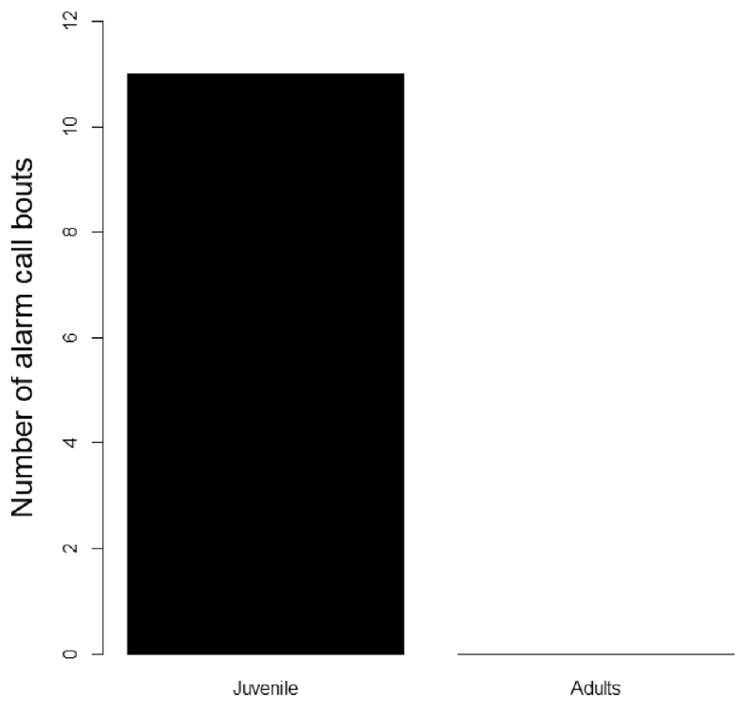
Young vervets alarm to unfamiliar raptor models
Social learning is behavioral change supported by information from other individuals. Mohr and colleagues showed unfamiliar raptor models to juvenile vervets, 1–2 years old, while watching nearby audiences. The juveniles could watch both the model and the reactions of other monkeys.
Juveniles sometimes alarmed to these models, whereas adults remained silent. Audience members were individuals within 10 m of the subject. The result matches the classic age pattern, in which more experienced adults judge unfamiliar models differently from younger animals.
Caller age and alarm production were associated in these observations. The developmental difference concerns calling behavior, and it is a separate matter from any age-specific neural circuit. The data set compares callers of different ages in the same setting.
Mohr et al. (2023), Fig. 1. Juvenile and adult alarm production to unfamiliar raptor models.
Mohr et al. (2023); Seyfarth et al. (1980a)
44
Notes:
• **Social learning** concerns behavioral change supported by information from other individuals. Mohr and colleagues presented unfamiliar raptor models to juvenile vervets aged 1–2 years while monitoring nearby audiences. The juveniles could inspect both the model and the reactions of other monkeys.
• Juveniles sometimes alarmed, whereas adults did not alarm to these models. Audience members were defined as individuals within 10 m of the subject. The comparison is consistent with more experienced adults judging the unfamiliar models differently from younger animals, as in the classic age-related category refinement.
• Caller age and alarm production were associated, but the preparation did not independently manipulate lifetime experience. Silence by an adult does not establish indifference or failure to detect the model. The measured developmental difference concerns calling behavior rather than the discovery of an age-specific neural circuit.
References:
Tecla Mohr, Erica van de Waal, Klaus Zuberbühler, Stéphanie Mercier (2023). Juvenile vervet monkeys rely on others when responding to danger. Animal Cognition 26(4):1443-1447. https://doi.org/10.1007/s10071-023-01765-2
Robert M. Seyfarth, Dorothy L. Cheney, Peter Marler (1980). Monkey Responses to Three Different Alarm Calls: Evidence of Predator Classification and Semantic Communication. Science 210(4471):801-803. https://doi.org/10.1126/science.7433999
Figure: Mohr et al. (2023), Fig. 1. Juvenile and adult alarm production to unfamiliar raptor models.
Figure source: https://doi.org/10.1007/s10071-023-01765-2

Slide 59
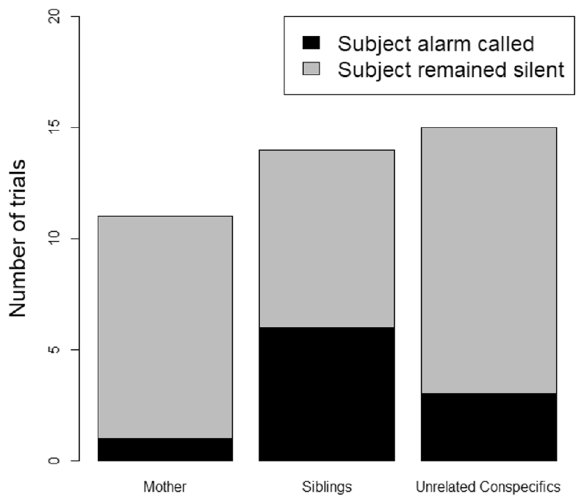
Audience patterns do not establish a learning mechanism
An audience effect is a change in signaling linked to who is nearby. Mohr and colleagues contrasted juvenile calling when mothers, siblings or unrelated group members were present within 10 m. Other relatives were left out of the mother and sibling conditions, which kept the audience categories apart.
The descriptive pattern showed more juvenile calling with siblings than with mothers or unrelated animals. Mothers and siblings also directed their vigilance toward the model, which supplied extra social information that the juveniles could use during each trial.
These observations motivate explanations that involve experience, relatedness or awareness. A difference in immediate calling is a different measure from a lasting acquired association, so the design supports a developmental interpretation of the calling pattern.
Mohr et al. (2023), Fig. 2. Juvenile alarm production in three audience conditions.
Mohr et al. (2023)
45
Notes:
• An **audience effect** is a change in signaling associated with who is nearby. Mohr and colleagues compared juvenile responses with mothers, siblings or unrelated group members present within 10 m. Other kin were excluded from the mother and sibling conditions to separate these audience categories.
• The descriptive pattern contained more juvenile calling with siblings than with mothers or unrelated animals. However, the study did not establish an overall audience-composition effect, and audience size was not systematically controlled. Model-directed vigilance by mothers and siblings provided additional social information.
• These observations motivate explanations involving experience, relatedness or awareness, but they do not demonstrate imitation, teaching or one-trial learning. A difference in immediate calling is distinct from a lasting acquired association. The restricted design therefore supports cautious developmental interpretation rather than a proven mechanism of alarm learning.
References:
Tecla Mohr, Erica van de Waal, Klaus Zuberbühler, Stéphanie Mercier (2023). Juvenile vervet monkeys rely on others when responding to danger. Animal Cognition 26(4):1443-1447. https://doi.org/10.1007/s10071-023-01765-2
Figure: Mohr et al. (2023), Fig. 2. Juvenile alarm production in three audience conditions.
Figure source: https://doi.org/10.1007/s10071-023-01765-2

Slide 60
Key takeaways
Functional reference is supported when call production relates to external events and playback elicits appropriate responses without the eliciting stimulus.
Classic playback controls separate acoustic effects from predator visibility; duration, amplitude and caller identity do not alone explain the response categories.
Context-sensitive reception allows the same broad call form to guide different actions or levels of vigilance depending on location, social events and prior evidence.
Developmental refinement narrows broad juvenile threat categories; age-related observations do not by themselves distinguish maturation, personal experience and social learning.
Acoustic overlap means predator-associated calls can resemble aggression calls; information-bearing reception does not require a universal one-call–one-predator dictionary.
Neural evidence locates macaque vocal sensitivity in auditory and anterior temporal regions, while regional imaging does not identify a vervet semantic circuit or molecular mechanism.
Seyfarth et al. (1980a, b); Price et al. (2015); Ortiz-Rios et al. (2015); Deshpande et al. (2023)
46
Notes:
Teaching transcript:
• Functional reference is supported when call production relates to external events and playback elicits appropriate responses without the eliciting stimulus.
• Classic playback controls separate acoustic effects from predator visibility; duration, amplitude and caller identity do not alone explain the response categories.
• Context-sensitive reception allows the same broad call form to guide different actions or levels of vigilance depending on location, social events and prior evidence.
• Developmental refinement narrows broad juvenile threat categories; age-related observations do not by themselves distinguish maturation, personal experience and social learning.
• Acoustic overlap means predator-associated calls can resemble aggression calls; information-bearing reception does not require a universal one-call–one-predator dictionary.
• Neural evidence locates macaque vocal sensitivity in auditory and anterior temporal regions, while regional imaging does not identify a vervet semantic circuit or molecular mechanism.
References:
Robert M. Seyfarth, Dorothy L. Cheney, Peter Marler (1980). Monkey Responses to Three Different Alarm Calls: Evidence of Predator Classification and Semantic Communication. Science 210(4471):801-803. https://doi.org/10.1126/science.7433999
Robert M. Seyfarth, Dorothy L. Cheney, Peter Marler (1980). Vervet monkey alarm calls: Semantic communication in a free-ranging primate. Animal Behaviour 28(4):1070-1094. https://doi.org/10.1016/S0003-3472(80)80097-2
Tabitha Price, Philip Wadewitz, Dorothy Cheney, Robert Seyfarth, Kurt Hammerschmidt, Julia Fischer (2015). Vervets revisited: A quantitative analysis of alarm call structure and context specificity. Scientific Reports 5(1):13220. https://doi.org/10.1038/srep13220
Tabitha Price, Julia Fischer (2014). Meaning attribution in the West African green monkey: influence of call type and context. Animal Cognition 17(2):277-286. https://doi.org/10.1007/s10071-013-0660-9
Adwait Deshpande, Erica van de Waal, Klaus Zuberbühler (2023). Context-dependent alarm responses in wild vervet monkeys. Animal Cognition 26(4):1199-1208. https://doi.org/10.1007/s10071-023-01767-0
Tecla Mohr, Erica van de Waal, Klaus Zuberbühler, Stéphanie Mercier (2023). Juvenile vervet monkeys rely on others when responding to danger. Animal Cognition 26(4):1443-1447. https://doi.org/10.1007/s10071-023-01765-2
Michael Ortiz-Rios, Paweł Kuśmierek, Iain DeWitt, Denis Archakov, Frederico A. C. Azevedo, Mikko Sams, Iiro P. Jääskeläinen, Georgios A. Keliris, Josef P. Rauschecker (2015). Functional MRI of the vocalization-processing network in the macaque brain. Frontiers in Neuroscience 9:113. https://doi.org/10.3389/fnins.2015.00113

