Slide 1
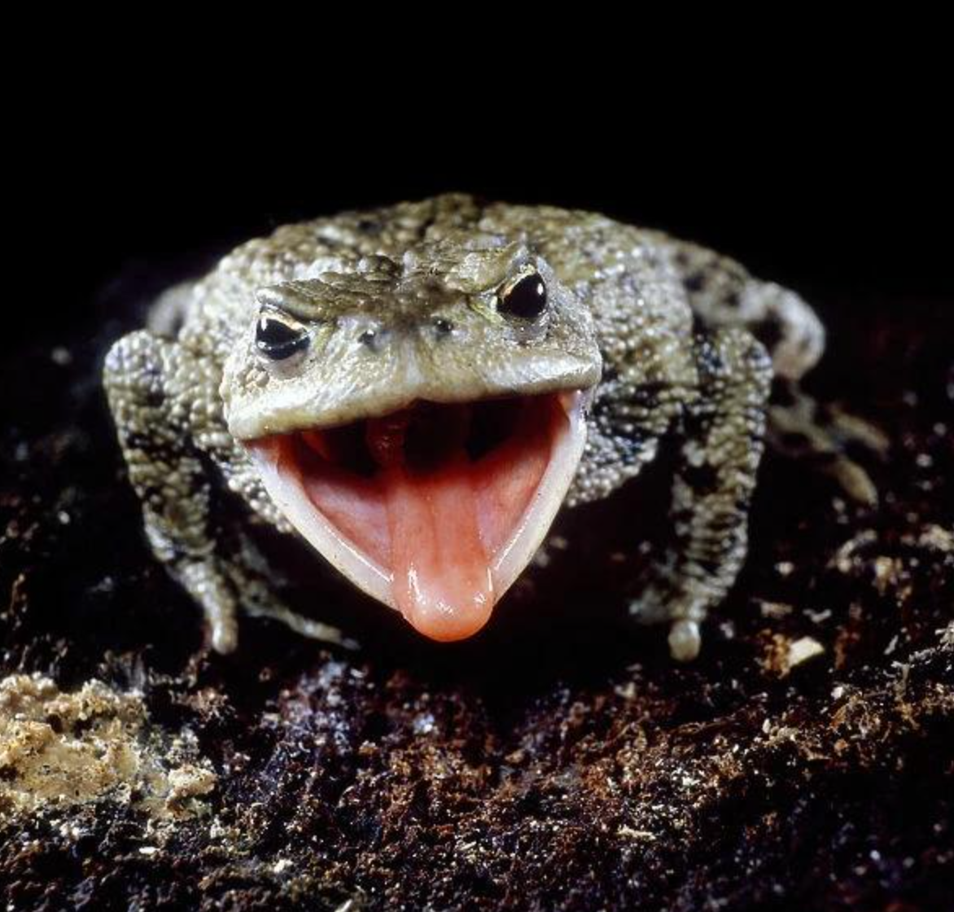
NEUR 411 · NEUROETHOLOGY · FALL 2026
Lecture 10
Amphibian prey capture II: pretectal predator-avoidance circuits
Wednesday, September 16, 2026
Jordan Lopez, Ph.D.
Photo: Common toad (Bufo bufo), the species used in Ewert's prey-catching studies.
Notes:
Amphibian prey capture II: pretectal predator-avoidance circuits
Wednesday, September 16, 2026
Photo: Common toad (Bufo bufo), the species used in Ewert's prey-catching studies.
Credit: George Chernilevsky
License: Public domain
Source: https://commons.wikimedia.org/wiki/File:Bufo_bufo_2009_G1.jpg

Slide 2
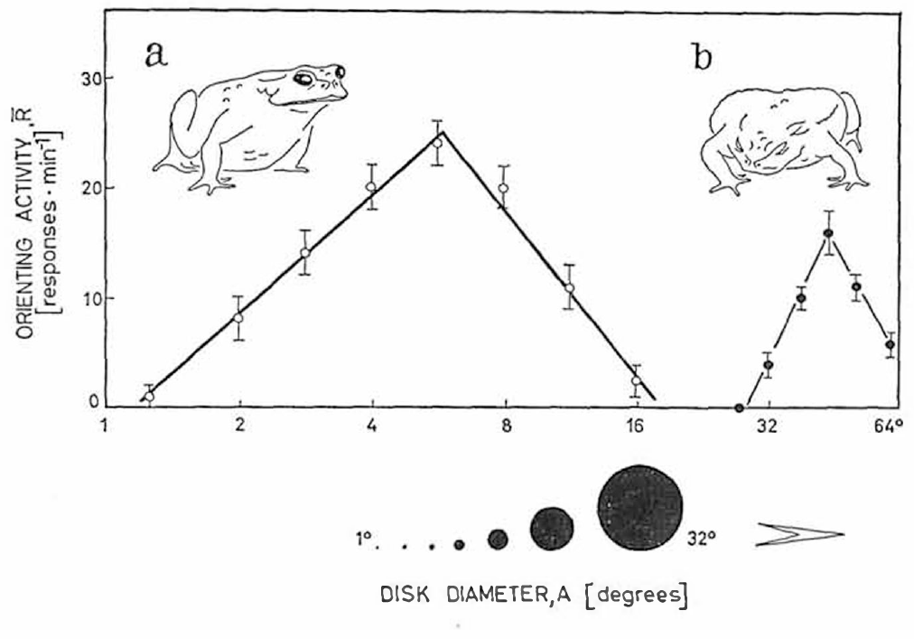
Large moving objects recruit defensive behavior
Predator avoidance is a movement that reduces exposure to a threatening object. In common toads, Bufo bufo, large moving objects evoke ducking, turning away or jumping, whereas small objects often evoke orienting followed by prey capture.
Ewert varied the angular diameter of black discs moving at 30°/s against a white background. Angular size is the angle an object occupies at the eye. Orienting was strongest for discs approximately 4–8° across and nearly absent at 20°; avoidance became prominent above 30° and was optimal around 50°.
The controlled objects separate stimulus size from actual predator identity. A single visual dimension is enough to switch the same moving disc from releasing prey capture to releasing escape, with the change occurring between about 20° and 30°.
Ewert (1970), Fig. 2(a–b). Disc diameter in degrees separates orienting and avoidance.
Ewert (1970)
02
Notes:
Teaching transcript:
**Predator avoidance** is a movement that reduces exposure to a threatening object. In common toads, _Bufo bufo_, large moving objects evoke ducking, turning away or jumping, whereas small objects often evoke orienting followed by prey capture.
Ewert varied the angular diameter of black discs moving at 30°/s against a white background. **Angular size** is the angle an object occupies at the eye. Orienting was strongest for discs approximately 4–8° across and nearly absent at 20°; avoidance became prominent above 30° and was optimal around 50°.
The controlled objects separate stimulus size from actual predator identity. These responses establish a size-dependent behavioral distinction; they do not imply that every large object is recognized as a particular predator.
The discs provide controlled visual cues without the odor, texture or unpredictable movements of a living animal. A laboratory avoidance response measures the animal’s action toward that cue; predator recognition in a natural encounter contains additional information.
References:
Ewert JP (1970). Neural mechanisms of prey-catching and avoidance behavior in the toad (Bufo bufo L.). Brain, Behavior and Evolution 3(1–4):36–56. https://doi.org/10.1159/000125462
Ewert (1970), Fig. 2(a–b). Disc diameter in degrees separates orienting and avoidance.
Figure source: https://doi.org/10.1159/000125462

Slide 3
Angular size merges object size with distance
Angular size depends on how large an object is and how far it lies from the eye. Doubling an object's width or halving its distance gives nearly the same angle, so an 8° disc could be a small object close by or a larger one farther away.
Ewert's discs circled the toad at a constant distance, so each angular diameter stood for one physical size, and the orienting and avoidance curves describe how the toad sorts retinal images. A toad sorting only by angle would treat a nearby beetle and a distant heron alike whenever their images matched.
An approaching animal enlarges its retinal image as the gap closes, so one object can move from the 4–8° prey range into the avoidance range above 30° during a single approach. McConville and Laming specified their worm-like object in centimeters, so its angular size depended on how far the toad sat from it.
Ewert (1970), Fig. 2(a–b). Disc diameter in degrees separates orienting and avoidance.
Ewert (1970); McConville & Laming (2007)
02a
Notes:
Angular size is the only size the eye receives directly, and it is fixed jointly by the object and the viewing distance. Slide 2 reports every stimulus in degrees, which only becomes a statement about real objects once that geometry is clear.
Two quantities in one number.
An object twice as wide at twice the distance covers about the same part of the retina, so the image alone is ambiguous about size.
For the small angles used in these experiments, the angle grows almost in proportion to width and shrinks almost in proportion to distance.
What the chamber fixes.
Slide 3 describes the object circling the toad inside a glass cylinder, which holds viewing distance steady during a test.
With distance held constant, Ewert's degree values can be read as object sizes, and the toad's curves become curves of retinal image size.
Why distance matters in natural encounters.
A predator walking toward a toad starts as a small image and grows steadily, so the same animal can fall inside the prey window early and inside the avoidance window later.
Slide 40 uses lengths in centimeters, and the speaker notes there warn against turning them into angles without knowing the viewing geometry; the angle depends on the toad's distance from the moving object.
References:
Ewert JP (1970). Neural mechanisms of prey-catching and avoidance behavior in the toad (Bufo bufo L.). Brain, Behavior and Evolution 3(1–4):36–56. https://doi.org/10.1159/000125462
McConville J, Laming PR (2007). DC electrical stimulation of the pretectal thalamus and its effects on the feeding behavior of the toad (Bufo bufo). Developmental Neurobiology 67(7):875–883. https://doi.org/10.1002/dneu.20390

Slide 4
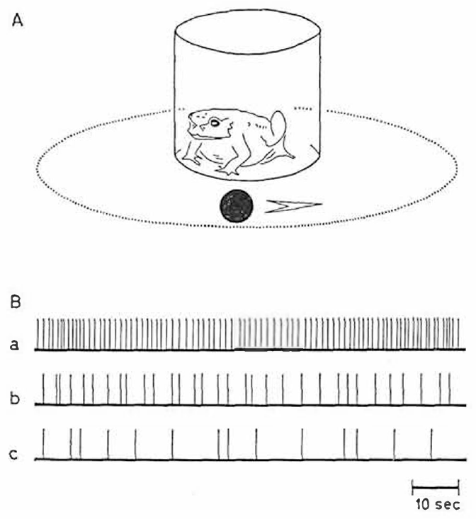
The same visual world supports approach and escape
Prey capture includes orienting, following, snapping and swallowing. Ewert counted turns while a moving object circled a toad inside a glass cylinder; the timed records distinguish persistent orientation from occasional responses without requiring the animal to catch real prey.
A small moving object normally activates approach-related behavior. A large object can instead cause the toad to lower its body or move away. These alternatives depend on visual dimensions and behavioral state, rather than on the presence or absence of motion alone.
Electrical stimulation near the boundary between catching and avoidance regions could evoke both kinds of movement in rapid succession or together. The muscles can therefore execute these responses without an absolute peripheral incompatibility; normal separation requires central regulation.
Ewert (1970), Fig. 1(A–B). Moving-object chamber and timed orienting responses.
Ewert (1970)
03
Notes:
Teaching transcript:
**Prey capture** includes orienting, following, snapping and swallowing. Ewert counted turns while a moving object circled a toad inside a glass cylinder; the timed records distinguish persistent orientation from occasional responses without requiring the animal to catch real prey.
A small moving object normally activates approach-related behavior. A large object can instead cause the toad to lower its body or move away. These alternatives depend on visual dimensions and behavioral state, rather than on the presence or absence of motion alone.
Electrical stimulation near the boundary between catching and avoidance regions could evoke both kinds of movement in rapid succession or together. The muscles can therefore execute these responses without an absolute peripheral incompatibility; normal separation requires central regulation.
Turning counts quantify one component of the feeding sequence. Snapping and swallowing are distinct motor acts, so an increase in orienting should not be equated with successful feeding. The mixed responses produced by electrical stimulation concern motor compatibility, not normal simultaneous pursuit and escape.
References:
Ewert JP (1970). Neural mechanisms of prey-catching and avoidance behavior in the toad (Bufo bufo L.). Brain, Behavior and Evolution 3(1–4):36–56. https://doi.org/10.1159/000125462
Ewert (1970), Fig. 1(A–B). Moving-object chamber and timed orienting responses.
Figure source: https://doi.org/10.1159/000125462

Slide 5
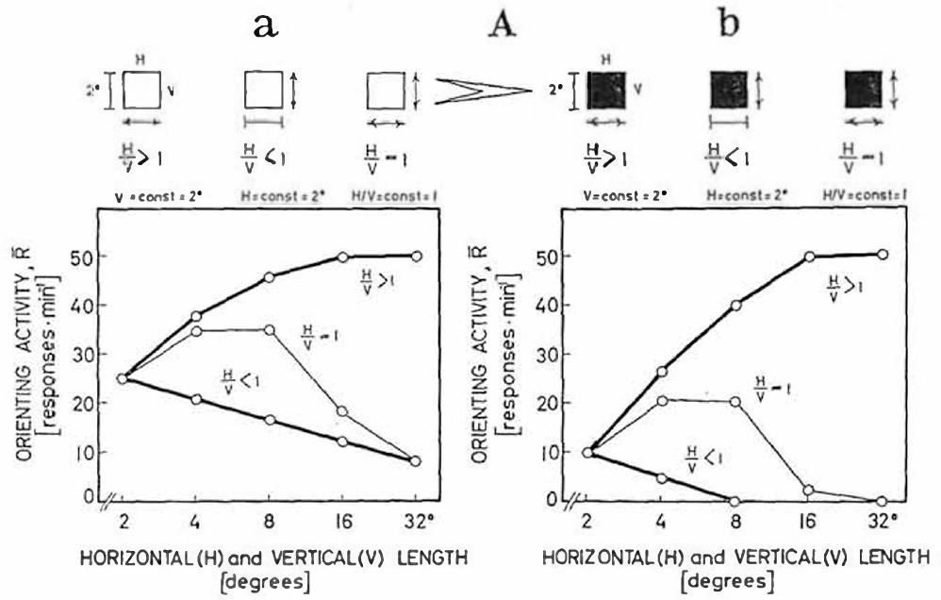
Elongation across motion suppresses prey orientation
A worm-like stimulus is a narrow rectangle moving parallel to its long axis. An antiworm stimulus has the same elongated form but moves perpendicular to that axis. These terms describe stimulus geometry rather than real species of prey.
At 30°/s, Ewert held one rectangle dimension at 2° while changing the other. Increasing length parallel to motion increased orienting toward a maximum at approximately 16–32°. Increasing width perpendicular to motion reduced the response. A square became more effective up to about 8° before larger squares lost prey value.
The opposite effects of elongation require a relation between object dimensions and movement direction. Two bars of equal area can carry opposite prey value; the preferred one matches a crawling worm, whose body extends along its path.
Ewert (1970), Fig. 3(Aa–Ab). Intact toads respond differently to rectangle elongation along and across motion.
Ewert (1970)
04
Notes:
Teaching transcript:
A **worm-like stimulus** is a narrow rectangle moving parallel to its long axis. An **antiworm stimulus** has the same elongated form but moves perpendicular to that axis. These terms describe stimulus geometry rather than real species of prey.
At 30°/s, Ewert held one rectangle dimension at 2° while changing the other. Increasing length parallel to motion increased orienting toward a maximum at approximately 16–32°. Increasing width perpendicular to motion reduced the response. A square became more effective up to about 8° before larger squares lost prey value.
The opposite effects of elongation require a relation between object dimensions and movement direction. Area alone cannot explain intact behavior, and the behavioral curves do not themselves identify the inhibitory neurons.
The same rectangular dimensions can have different behavioral effects after the movement direction is changed. The manipulation tests configuration selectivity: sensitivity to how parts of the stimulus are arranged relative to motion. The original curves distinguish that selectivity from a simple preference for more dark area.
References:
Ewert JP (1970). Neural mechanisms of prey-catching and avoidance behavior in the toad (Bufo bufo L.). Brain, Behavior and Evolution 3(1–4):36–56. https://doi.org/10.1159/000125462
Ewert (1970), Fig. 3(Aa–Ab). Intact toads respond differently to rectangle elongation along and across motion.
Figure source: https://doi.org/10.1159/000125462

Slide 6
Length and width pull prey value in opposite ways
Ewert's rectangle curves behave as if prey value combined two opposing contributions: extent along the direction of motion raises it, extent across the motion lowers it, and each rectangle's response reflects the balance.
A square enlarges both dimensions together. At small sizes the gain from added length outweighs the loss from added height, so orienting rises; beyond about 8°, the cross-motion contribution comes to dominate and the square loses prey value. One curve that rises and then falls thus follows from two simpler relations acting at once.
Opposing contributions also predict what a lesion of the subtractive part would do: every enlargement would then raise orienting, with no new detector required. Pretectal and caudal thalamic damage produced exactly that pattern, which places the cross-motion penalty in the damaged pathway while the length benefit survives.
Ewert (1970), Fig. 3(Aa–Ab). Intact toads respond differently to rectangle elongation along and across motion.
Ewert (1970)
04a
Notes:
The three curves on slide 4 look like three separate findings, but one rule with an adding part and a subtracting part produces all of them.
Two contributions, opposite signs.
Lengthening a bar along its path makes it more worm-like and more effective, up to a point.
Widening it across its path makes it less effective even though the visible dark area increases.
The square as a test of the rule.
A square grows in both directions at once, so both contributions change together.
While the square is small, the benefit of extra length wins, and orienting increases; once it passes roughly 8°, the penalty for extra height outweighs that benefit and prey value falls.
The square curve is therefore not a third preference but the sum of the first two.
The lesion prediction.
Removing only the subtracting part should leave a system in which any enlargement helps.
Slide 11 reports that after effective lesions orienting increased with enlargement along either axis, which is the predicted outcome and locates the penalty in the damaged pretectal and caudal thalamic tissue.
References:
Ewert JP (1970). Neural mechanisms of prey-catching and avoidance behavior in the toad (Bufo bufo L.). Brain, Behavior and Evolution 3(1–4):36–56. https://doi.org/10.1159/000125462

Slide 7
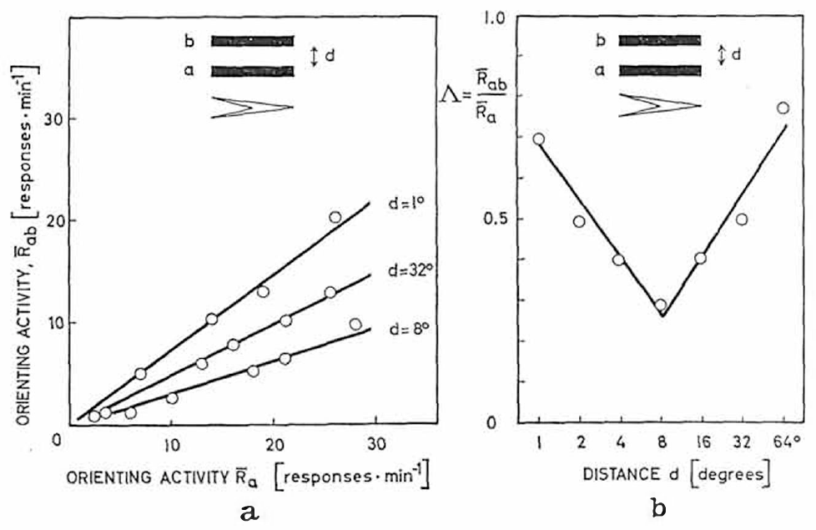
Neighboring objects can inhibit orienting
Spatial interaction means that the response to one object depends on another object elsewhere in the visual field. Ewert compared orientation toward a single moving rectangle with orientation when a second rectangle moved alongside it, using the same 30°/s speed and high contrast.
For paired 2° × 16° objects, suppression was greatest at approximately 8° separation. Objects farther apart produced less inhibition. Adding a second potential prey item therefore did not necessarily add a second independent orienting response.
The manipulation supplies a behavioral constraint on visual processing: nearby signals interact before the final movement is selected. After pretectal and caudal thalamic lesions the same pairs summed instead, tying the interaction to the region that restrains catching.
Ewert (1970), Fig. 4(a–b). Paired moving objects inhibit orienting most strongly at 8° separation.
Ewert (1970)
05
Notes:
Teaching transcript:
**Spatial interaction** means that the response to one object depends on another object elsewhere in the visual field. Ewert compared orientation toward a single moving rectangle with orientation when a second rectangle moved alongside it, using the same 30°/s speed and high contrast.
For paired 2° × 16° objects, suppression was greatest at approximately 8° separation. Objects farther apart produced less inhibition. Adding a second potential prey item therefore did not necessarily add a second independent orienting response.
The manipulation supplies a behavioral constraint on visual processing: nearby signals interact before the final movement is selected. It does not localize the interaction exclusively to retina, pretectum or tectum without a separate intervention.
The single-object condition provides the comparison needed to distinguish inhibition from simple failure to detect either object. Separation changes while the object dimensions are retained. The spatial dependence concerns response selection, and it does not establish a synapse between two identified cells.
References:
Ewert JP (1970). Neural mechanisms of prey-catching and avoidance behavior in the toad (Bufo bufo L.). Brain, Behavior and Evolution 3(1–4):36–56. https://doi.org/10.1159/000125462
Ewert (1970), Fig. 4(a–b). Paired moving objects inhibit orienting most strongly at 8° separation.
Figure source: https://doi.org/10.1159/000125462

Slide 8
Mutual inhibition aims orienting at one target
Lateral inhibition is suppression of a neuron's response by activity at neighboring positions of a sensory map. When two moving objects fall close together, each excites its own map position and suppresses the other's, so the stronger or earlier signal can dominate while the weaker one drops out.
Tectal stimulation turns the toad toward the sector represented at the stimulated site, so tectal activity is an aiming signal. Two nearby targets driving the map without competition could aim a turn between them, at a point holding no prey.
Frog tectal newness cells have receptive fields of about 15–20°, wider than the 8° separation of strongest suppression, so two items at that spacing can fall inside one cell's field. Wider spacing places them in different cells' fields, where mutual suppression weakens and each item can attract its own turn.
Ewert (1970), Fig. 4(a–b). Paired moving objects inhibit orienting most strongly at 8° separation.
Ewert (1970); Ingle (1973)
05a
Notes:
The paired-object result on slide 5 reflects a general property of sensory maps, competition between neighboring locations, and that competition has a clear payoff for an animal that must aim a strike.
Competition on a map.
In lateral inhibition, active map positions suppress their neighbors, which sharpens the difference between a strong input and a weak one nearby.
Applied to two moving bars, the arrangement favors one bar over the other instead of letting both drive orienting equally.
Why one target matters.
Slide 7 establishes that tectal sites direct turns and snaps toward particular sectors of visual space.
A map that merged two nearby inputs into one broad patch of activity would point the snap at the middle of the patch, which could fall in empty space between two insects.
Selecting a single winner keeps the aiming signal centered on a real object.
The spatial scale.
Slide 15 gives normal newness-cell fields of about 15 to 20 degrees, so objects 8 degrees apart can share a single field, while widely separated objects fall in different fields.
After pretectal lesions, slide 12 reports summation instead of suppression, so the competition depends on the same region that restrains catching.
References:
Ewert JP (1970). Neural mechanisms of prey-catching and avoidance behavior in the toad (Bufo bufo L.). Brain, Behavior and Evolution 3(1–4):36–56. https://doi.org/10.1159/000125462
Ingle D (1973). Disinhibition of tectal neurons by pretectal lesions in the frog. Science 180(4084):422–424. https://doi.org/10.1126/science.180.4084.422

Slide 9
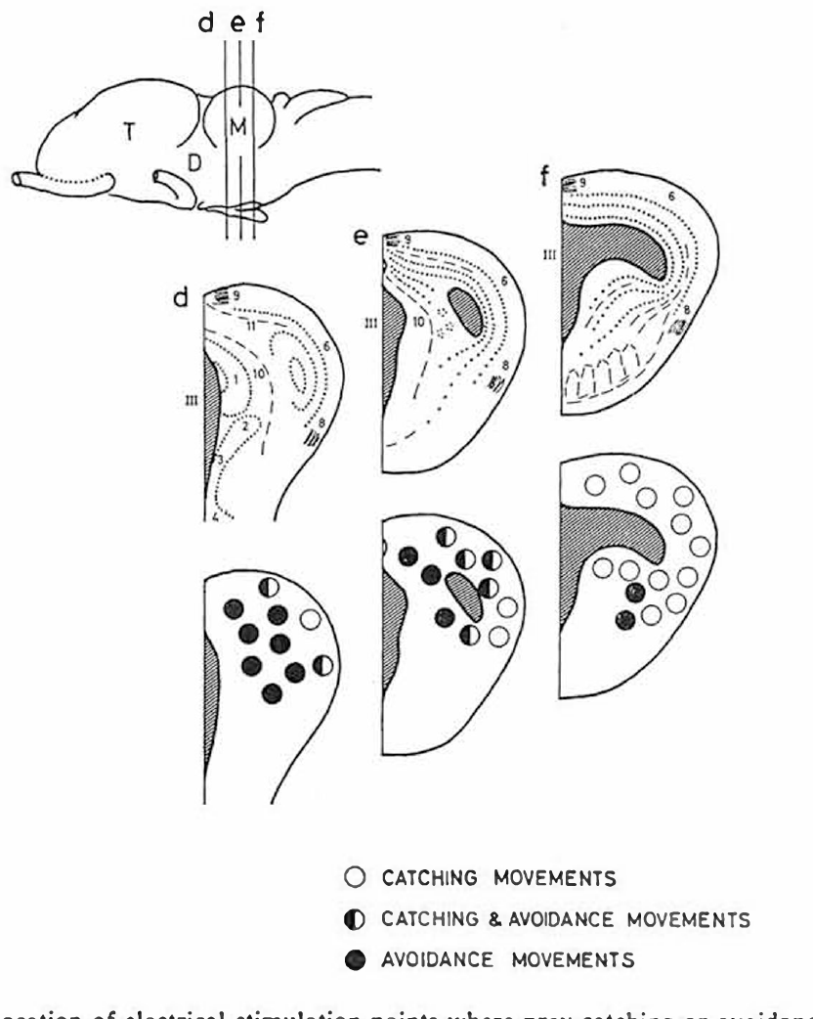
Avoidance sites lie rostral to the tectum
The optic tectum is the midbrain visual structure involved in directing movements toward visual targets. The pretectum lies immediately rostral to it, near the caudal diencephalon. Ewert mapped responses by stimulating localized sites in freely moving toads.
Stimulation in the pretectal and adjacent caudal dorsal thalamic regions evoked ducking, jumping or turning away from the opposite side. The published site maps distinguish these locations from tectal sites associated with catching movements and from boundary sites producing mixed responses.
Electrical stimulation establishes that activity introduced near these regions can recruit defensive motor behavior. Each movement led away from the opposite side, so the avoidance region carries information about where a threat lies, as the tectum does for prey.
Ewert (1970), Fig. 7(d–f). Catching and avoidance stimulation sites.
Ewert (1970)
06
Notes:
Teaching transcript:
The **optic tectum** is the midbrain visual structure involved in directing movements toward visual targets. The **pretectum** lies immediately rostral to it, near the caudal diencephalon. Ewert mapped responses by stimulating localized sites in freely moving toads.
Stimulation in the pretectal and adjacent caudal dorsal thalamic regions evoked ducking, jumping or turning away from the opposite side. The published site maps distinguish these locations from tectal sites associated with catching movements and from boundary sites producing mixed responses.
Electrical stimulation establishes that activity introduced near these regions can recruit defensive motor behavior. Current can activate axons as well as nearby neurons, so a behavioral stimulation map does not identify a single specialized predator neuron.
Rostral means toward the front of the brain, while caudal means toward the back. The anatomical names used in these classic papers partly overlap, which is why the original stimulation and lesion maps are more precise than assigning every effect to a modern nucleus label.
References:
Ewert JP (1970). Neural mechanisms of prey-catching and avoidance behavior in the toad (Bufo bufo L.). Brain, Behavior and Evolution 3(1–4):36–56. https://doi.org/10.1159/000125462
Ewert (1970), Fig. 7(d–f). Catching and avoidance stimulation sites.
Figure source: https://doi.org/10.1159/000125462

Slide 10
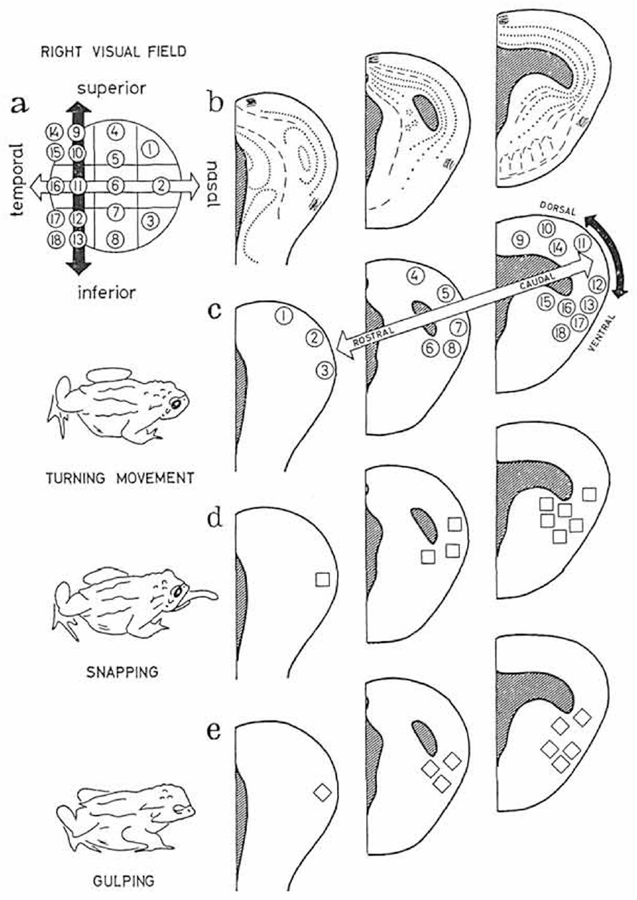
Tectal stimulation directs distinct catching movements
Ewert implanted electrodes in the optic tectum and applied pulse trains to freely moving toads. Appropriate stimulation could evoke turning, snapping and gulping without a prey object passing through the corresponding part of the visual field.
Different tectal locations directed orienting or snapping toward different sectors of the opposite visual field. This retinotopic organization preserves spatial relationships from the retina, the light-sensitive neural tissue of the eye, in a central map used to direct movement.
The stimulation bypasses normal stimulus classification but preserves a relation between brain location and movement direction. The tectum therefore holds the motor map that aims each catching act, and pretectal lesions later released these same turning and snapping movements toward unsuitable objects.
Ewert (1970), Fig. 6(a–e). Tectal stimulation sites and directed turning, snapping and gulping.
Ewert (1970)
07
Notes:
Teaching transcript:
Ewert implanted electrodes in the optic tectum and applied pulse trains to freely moving toads. Appropriate stimulation could evoke turning, snapping and gulping without a prey object passing through the corresponding part of the visual field.
Different tectal locations directed orienting or snapping toward different sectors of the opposite visual field. This **retinotopic organization** preserves spatial relationships from the retina, the light-sensitive neural tissue of the eye, in a central map used to direct movement.
The stimulation bypasses normal stimulus classification but preserves a relation between brain location and movement direction. It supports a tectal contribution to visuomotor output; it does not establish that the tectum operates independently of pretectal inhibition or other brain regions.
The spatial map concerns where an action is directed, while stimulus selectivity concerns which visual objects release that action. A stimulation experiment can activate an output location without testing whether the same site would normally accept a large nonprey stimulus.
References:
Ewert JP (1970). Neural mechanisms of prey-catching and avoidance behavior in the toad (Bufo bufo L.). Brain, Behavior and Evolution 3(1–4):36–56. https://doi.org/10.1159/000125462
Ewert (1970), Fig. 6(a–e). Tectal stimulation sites and directed turning, snapping and gulping.
Figure source: https://doi.org/10.1159/000125462

Slide 11
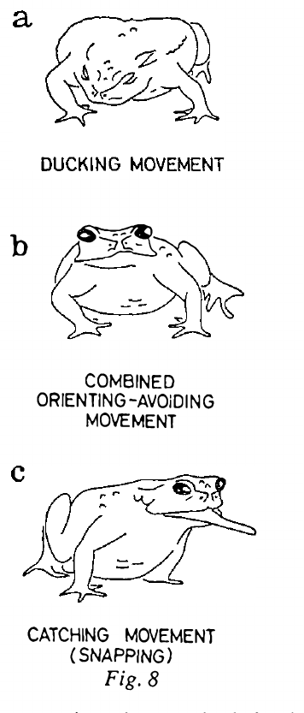
Prolonged pretectal stimulation reverses behavior
Ewert prolonged stimulation of the pretectal and caudal thalamic region at 60 Hz. The initial effect was an avoidance response, but continued stimulation raised the avoidance threshold and eventually produced unresponsiveness to the stimulation.
During a later phase, toads oriented and snapped toward large moving objects that they would ordinarily avoid. The response progressed from ducking through mixed orienting–avoidance movements to catching movements. After approximately 10–30 minutes of recovery, appropriate avoidance could return.
This reversible sequence is consistent with temporary loss of a restraining influence on prey capture. Behavior passed through the same mixed orienting and avoidance movements evoked at boundary stimulation sites, so catching and avoidance compete continuously rather than switching all at once.
Ewert (1970), Fig. 7(d–f). Catching and avoidance stimulation sites.
Ewert (1970), Fig. 8(a–c). Prolonged stimulation changes ducking to mixed responses and snapping.
Ewert (1970)
08
Notes:
Teaching transcript:
Ewert prolonged stimulation of the pretectal and caudal thalamic region at 60 Hz. The initial effect was an avoidance response, but continued stimulation raised the avoidance threshold and eventually produced unresponsiveness to the stimulation.
During a later phase, toads oriented and snapped toward large moving objects that they would ordinarily avoid. The response progressed from ducking through mixed orienting–avoidance movements to catching movements. After approximately 10–30 minutes of recovery, appropriate avoidance could return.
This reversible sequence is consistent with temporary loss of a restraining influence on prey capture. It does not establish whether the loss results from adaptation, transmitter depletion, altered ionic conditions or another consequence of sustained electrical activation.
A pulse frequency of 60 Hz means sixty stimulation pulses per second, not a measured firing rate of every pretectal cell. The recovery distinguishes the prolonged-stimulation effect from a permanently destroyed motor pathway, but it does not supply the cellular cause of the changing response.
References:
Ewert JP (1970). Neural mechanisms of prey-catching and avoidance behavior in the toad (Bufo bufo L.). Brain, Behavior and Evolution 3(1–4):36–56. https://doi.org/10.1159/000125462
Ewert (1970), Fig. 8(a–c). Prolonged stimulation changes ducking to mixed responses and snapping.
Figure source: https://doi.org/10.1159/000125462
Ewert (1970), Fig. 7(d–f). Catching and avoidance stimulation sites.
Figure source: https://doi.org/10.1159/000125462

Slide 12
Sustained stimulation turns activation into silencing
Electrical stimulation and lesions answer different questions. Activating a region tests whether its activity is sufficient to produce a behavior; removing it tests whether the region is necessary for behavior to stay normal. Brief pretectal stimulation answered the first question with ducking and turning away.
Prolonged 60 Hz stimulation turned one experiment into both tests. At first the driven region evoked avoidance; once the tissue stopped answering, it acted as a temporary lesion, and the toad snapped at large objects as lesioned toads did.
Agreement between the two phases gives stronger evidence than either alone. A region that only generated avoidance would leave catching untouched when silenced, and a region that only blocked catching would not evoke ducking when driven. The pretectal and caudal thalamic region did both, within one animal and one electrode site.
Ewert (1970), Fig. 7(d–f). Catching and avoidance stimulation sites.
Ewert (1970), Fig. 8(a–c). Prolonged stimulation changes ducking to mixed responses and snapping.
Ewert (1970)
08a
Notes:
Slide 8 can be read as a curiosity of long stimulation, but it combines the logic of slide 6 and slide 9 in a single preparation.
Two experimental questions.
Driving a region asks what its activity can produce, and the answer on slide 6 is defensive movement.
Removing a region asks what behavior needs it, and the answer on slide 9 is normal restriction of catching to suitable targets.
One electrode, both answers.
At the start of prolonged stimulation the pretectal site behaved as in the brief-stimulation maps and evoked ducking.
As the stimulation continued and the tissue became unresponsive, the toad snapped at large objects it would normally avoid, which is the lesion syndrome without a lesion.
Since the electrode never moved, the same tissue produced both effects.
What the agreement rules out.
If avoidance and restraint of catching lived in separate tissue, silencing the avoidance site would not release catching.
The reversal at a single site therefore ties escape and the restraint of prey capture to one region.
References:
Ewert JP (1970). Neural mechanisms of prey-catching and avoidance behavior in the toad (Bufo bufo L.). Brain, Behavior and Evolution 3(1–4):36–56. https://doi.org/10.1159/000125462

Slide 13
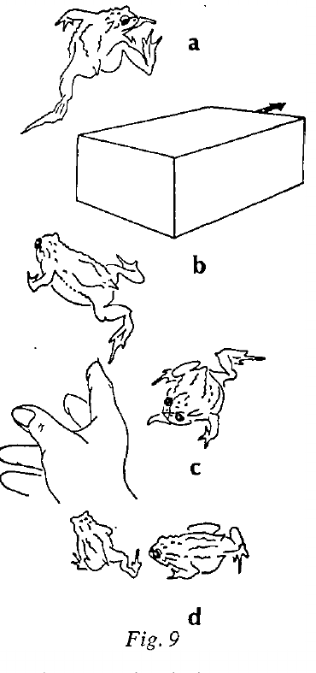
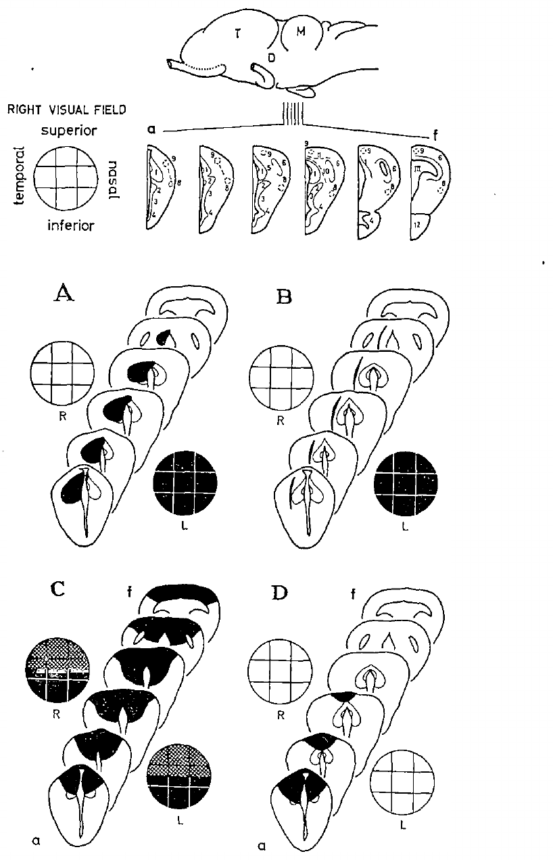
Pretectal lesions release inappropriate prey capture
A lesion is tissue damage introduced to test the contribution of a brain region or connection. Ewert used knife cuts and high-frequency coagulation in pretectal and caudal dorsal thalamic areas that normally participate in avoidance-related regulation.
After these lesions, toads snapped at their own legs, another toad, an experimenter’s hand or a moving shoe box. Disinhibition is increased activity or behavior after a restraining influence is removed. The abnormal catching could persist from 24 hours to several weeks, depending on lesion location.
The animals retained the motor capacity to orient and snap but lost normal restrictions on suitable targets. Snapping at their own legs means the lesioned toads no longer excluded even their own moving body parts, a restriction the intact pretectal region normally supplies.
Ewert (1970), Fig. 10(A–D). Lesion maps and visual fields.
Ewert (1970), Fig. 9(a–d). Disinhibited toads pursue large and inappropriate objects.
Ewert (1970)
09
Notes:
Teaching transcript:
A **lesion** is tissue damage introduced to test the contribution of a brain region or connection. Ewert used knife cuts and high-frequency coagulation in pretectal and caudal dorsal thalamic areas that normally participate in avoidance-related regulation.
After these lesions, toads snapped at their own legs, another toad, an experimenter’s hand or a moving shoe box. **Disinhibition** is increased activity or behavior after a restraining influence is removed. The abnormal catching could persist from 24 hours to several weeks, depending on lesion location.
The animals retained the motor capacity to orient and snap but lost normal restrictions on suitable targets. Because the lesions affected tissue and passing connections, they establish a regional contribution rather than the necessity of one transmitter or cell class.
An animal that still snaps is not simply blind or paralyzed. Its visually released behavior has changed in selectivity. The variable duration and lesion extent also prevent treating every operated animal as a selective and identical removal of a single inhibitory nucleus.
References:
Ewert JP (1970). Neural mechanisms of prey-catching and avoidance behavior in the toad (Bufo bufo L.). Brain, Behavior and Evolution 3(1–4):36–56. https://doi.org/10.1159/000125462
Ewert (1970), Fig. 9(a–d). Disinhibited toads pursue large and inappropriate objects.
Figure source: https://doi.org/10.1159/000125462
Ewert (1970), Fig. 10(A–D). Lesion maps and visual fields.
Figure source: https://doi.org/10.1159/000125462

Slide 14
Lesion effects follow sectors of visual space
Ewert reconstructed the damaged tissue and compared lesion location with the visual-field region in which catching became disinhibited. A unilateral pretectal or caudal thalamic lesion generally released prey-catching through the opposite eye; bilateral damage affected both sides.
Small lesions could change orienting in restricted visual sectors. When damage extended into dorsal tectal tissue, responses could disappear in the upper visual field while remaining disinhibited in the lower field. Losing visual responsiveness and releasing an inappropriate response are therefore distinguishable outcomes.
The spatial correspondence supports organized pretectal–tectal regulation rather than a completely uniform increase in movement. Large rostral thalamic lesions did not produce the same syndrome, so the release depends on where the damage lies and not on brain surgery as such.
Ewert (1970), Fig. 10(A–D). Lesion maps and visual fields.
Ewert (1970)
10
Notes:
Teaching transcript:
Ewert reconstructed the damaged tissue and compared lesion location with the visual-field region in which catching became disinhibited. A unilateral pretectal or caudal thalamic lesion generally released prey-catching through the opposite eye; bilateral damage affected both sides.
Small lesions could change orienting in restricted visual sectors. When damage extended into dorsal tectal tissue, responses could disappear in the upper visual field while remaining disinhibited in the lower field. Losing visual responsiveness and releasing an inappropriate response are therefore distinguishable outcomes.
The spatial correspondence supports organized pretectal–tectal regulation rather than a completely uniform increase in movement. Extensive lesions nevertheless combine loss of inputs, local neurons and connections, limiting assignment of the effect to an isolated synapse.
Contralateral refers to the side opposite a lesion; ipsilateral refers to the same side. A visual-field sector with no response after tectal damage cannot be counted as improved selectivity. The lesion reconstructions connect the behavioral deficit to damaged tissue without claiming microscopic selectivity.
Large rostral thalamic lesions did not produce the same syndrome, providing a location control. The caudal lesion effect therefore cannot be explained simply by any brain operation increasing snapping.
References:
Ewert JP (1970). Neural mechanisms of prey-catching and avoidance behavior in the toad (Bufo bufo L.). Brain, Behavior and Evolution 3(1–4):36–56. https://doi.org/10.1159/000125462
Ewert (1970), Fig. 10(A–D). Lesion maps and visual fields.
Figure source: https://doi.org/10.1159/000125462

Slide 15
Crossed optic projections explain one-sided release
In frogs and toads nearly all optic nerve fibers cross to the opposite side of the brain, so each eye projects to the tectum and pretectum of the other hemisphere. The left eye's visual field is mapped in the right tectum, where the right pretectum can act on it.
A right pretectal lesion removes restraint from the right tectum only, which serves the left eye, so catching is released through the eye opposite the damage. Sector-limited effects of small lesions mean each part of the pretectum restrains the tectal region serving the same part of visual space.
Ipsilateral pretectal stimulation produced its largest negative wave at particular rostral dorsomedial tectal sites, a physiological counterpart of this point-to-point arrangement. Topographic restraint would allow a toad to reject a large object on one side while still catching prey on the other.
Ewert (1970), Fig. 10(A–D). Lesion maps and visual fields.
Ewert (1970); Schwippert et al. (1995)
10a
Notes:
The side and sector rules on slide 10 follow directly from how the eyes connect to the midbrain.
The crossing.
In anuran amphibians the optic nerves cross almost completely, so each tectum and each pretectum receive the opposite eye.
Slide 26 relies on this arrangement when the contralateral optic nerve is stimulated to drive the recorded tectum.
Matching restraint to the map.
Damage on one side removes restraint only from the tectum on that side, and that tectum represents the opposite eye's field.
Small lesions altered orienting only in restricted sectors, which requires the restraint to be delivered region by region rather than as one signal for the whole tectum.
Slide 7 supplies the motor half of the arrangement: each tectal location aims movements at its own sector.
Physiological support and behavioral meaning.
On slide 29 the pretectal effect is concentrated at rostral dorsomedial recording sites, consistent with a mapped projection.
A restraint organized by location would let decisions about suitability be made separately for different parts of the visual field.
References:
Ewert JP (1970). Neural mechanisms of prey-catching and avoidance behavior in the toad (Bufo bufo L.). Brain, Behavior and Evolution 3(1–4):36–56. https://doi.org/10.1159/000125462
Schwippert WW, Beneke TW, Ewert JP (1995). Pretecto-tectal influences. II. How retinal and pretectal inputs to the toad’s superficial tectum interact: a study of electrically evoked field potentials. Journal of Comparative Physiology A 176(2):181–192. https://doi.org/10.1007/BF00239921

Slide 16
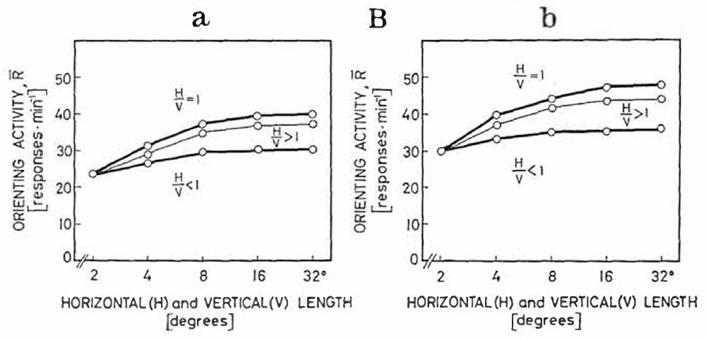
Lesions remove the effect of vertical elongation
Ewert repeated the rectangle-dimension experiment after pretectal and caudal thalamic lesions. In intact toads, elongating a rectangle perpendicular to its movement normally reduced prey-oriented turning, despite increasing the amount of visible object.
After the effective lesions, orienting instead increased with enlargement along either axis. Rectangles and squares no longer produced the same configuration-dependent reduction. The measured stimulus dimensions and 30°/s movement were retained, separating the lesion effect from a new set of visual objects.
The lost distinction supports a contribution of the damaged pathway to rejecting unsuitable configurations. Without it, a bar elongated across its motion became more attractive as it grew, so the lesioned toad treated larger moving objects as better prey.
Ewert (1970), Fig. 10(A–D). Lesion maps and visual fields.
Ewert (1970), Fig. 3(Ba–Bb). Lesioned toads lose the usual inhibition by vertical elongation.
Ewert (1970)
11
Notes:
Teaching transcript:
Ewert repeated the rectangle-dimension experiment after pretectal and caudal thalamic lesions. In intact toads, elongating a rectangle perpendicular to its movement normally reduced prey-oriented turning, despite increasing the amount of visible object.
After the effective lesions, orienting instead increased with enlargement along either axis. Rectangles and squares no longer produced the same configuration-dependent reduction. The measured stimulus dimensions and 30°/s movement were retained, separating the lesion effect from a new set of visual objects.
The lost distinction supports a contribution of the damaged pathway to rejecting unsuitable configurations. It does not mean that the retina has ceased detecting motion or that every surviving tectal neuron has become equally responsive to all stimuli.
The comparison is within the original stimulus family: horizontal, vertical and jointly enlarged dimensions. Increased response after damage is meaningful because the intact condition had a selective reduction for enlargement across motion, rather than a general failure to respond to large objects.
References:
Ewert JP (1970). Neural mechanisms of prey-catching and avoidance behavior in the toad (Bufo bufo L.). Brain, Behavior and Evolution 3(1–4):36–56. https://doi.org/10.1159/000125462
Ewert (1970), Fig. 3(Ba–Bb). Lesioned toads lose the usual inhibition by vertical elongation.
Figure source: https://doi.org/10.1159/000125462
Ewert (1970), Fig. 10(A–D). Lesion maps and visual fields.
Figure source: https://doi.org/10.1159/000125462

Slide 17
Restraint must carry information about object shape
A lesion can remove a configuration-specific penalty only if the removed tissue carried configuration information. Uniform inhibition would lower responses to worm and antiworm bars alike and preserve the difference between them; the selective loss means the restraint was strongest for objects extended across their motion.
Pretectal TH3 cells are tuned to big moving objects and to nonprey shapes. Inhibition from such cells onto prey-related tectal units would subtract most for the shapes the toad should reject, producing antiworm suppression in the intact animal.
Single tectal units support this arrangement at the cellular level: T5(2) units that separated worm from antiworm before a pretectal cut lost that distinction after it. Part of the configuration filter therefore lies in the input tectal neurons receive from the pretectum, not only in their retinal input.
Ewert (1970), Fig. 3(Ba–Bb). Lesioned toads lose the usual inhibition by vertical elongation.
Ewert (1970); Laming & Ewert (1983); McConville & Laming (2007)
11a
Notes:
Slide 11 shows a lost distinction, and the form of that loss says something about what the missing tissue was doing.
Uniform versus selective restraint.
If the pretectal region simply turned all tectal activity down, removing it would raise responses to every bar by a similar amount and keep the worm-like preference intact.
Instead the antiworm penalty disappeared, so the removed restraint had to depend on object configuration.
A candidate source.
The speaker notes on slide 45 define TH3 as a pretectal class tuned to big moving objects and nonprey shapes.
Cells tuned that way, if they inhibit tectal prey-related units, would remove the most activity for antiworm and large objects and the least for worm-like ones.
The cellular test.
Laming and Ewert held individual T5(2) units before and after a pretectal cut, as described on slide 19.
On slide 24 those units lost their worm versus antiworm distinction, the single-cell counterpart of the behavioral loss on slide 11.
References:
Ewert JP (1970). Neural mechanisms of prey-catching and avoidance behavior in the toad (Bufo bufo L.). Brain, Behavior and Evolution 3(1–4):36–56. https://doi.org/10.1159/000125462
Laming PR, Ewert JP (1983). The effects of pretectal lesions on neuronal, sustained potential shift and electroencephalographic responses of the toad tectum to presentation of a visual stimulus. Comparative Biochemistry and Physiology Part A: Physiology 76(2):247–252. https://doi.org/10.1016/0300-9629(83)90322-5
McConville J, Laming PR (2007). DC electrical stimulation of the pretectal thalamus and its effects on the feeding behavior of the toad (Bufo bufo). Developmental Neurobiology 67(7):875–883. https://doi.org/10.1002/dneu.20390

Slide 18
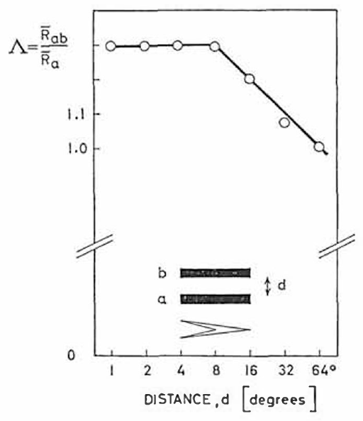
Paired objects sum after the restraint is removed
Ewert tested pairs of moving 2° × 16° rectangles after effective caudal thalamic and pretectal lesions. The object dimensions and speed matched the earlier intact preparation, allowing the distance-dependent interaction to be compared directly.
The normal reduction around 8° separation was absent. At separations of approximately 1–8°, the pair could produce more orienting than one object alone. Summation describes that combined increase, without requiring a particular mathematical rule for addition of neuronal signals.
The lesion changed how multiple visible targets competed for behavior. The same lesions also removed suppression by vertical elongation, so one damaged region released two separate restrictions on what the toad attacks: object configuration and nearby competing objects.
Ewert (1970), Fig. 10(A–D). Lesion maps and visual fields.
Ewert (1970), Fig. 11. Paired-object summation after lesions, with separation in degrees.
Ewert (1970)
12
Notes:
Teaching transcript:
Ewert tested pairs of moving 2° × 16° rectangles after effective caudal thalamic and pretectal lesions. The object dimensions and speed matched the earlier intact preparation, allowing the distance-dependent interaction to be compared directly.
The normal reduction around 8° separation was absent. At separations of approximately 1–8°, the pair could produce more orienting than one object alone. **Summation** describes that combined increase, without requiring a particular mathematical rule for addition of neuronal signals.
The lesion changed how multiple visible targets competed for behavior. The result supports a central inhibitory contribution to spatial filtering, but it does not determine whether the relevant normal interaction is carried by a direct pretectal projection or by an intervening network.
The paired-object result differs from the size experiment because two spatially distinct targets are present. A common lesion can remove both configuration-dependent suppression and nearby-object suppression, but similar behavioral effects do not prove that the underlying neuronal operations are identical.
References:
Ewert JP (1970). Neural mechanisms of prey-catching and avoidance behavior in the toad (Bufo bufo L.). Brain, Behavior and Evolution 3(1–4):36–56. https://doi.org/10.1159/000125462
Ewert (1970), Fig. 11. Paired-object summation after lesions, with separation in degrees.
Figure source: https://doi.org/10.1159/000125462
Ewert (1970), Fig. 10(A–D). Lesion maps and visual fields.
Figure source: https://doi.org/10.1159/000125462

Slide 19
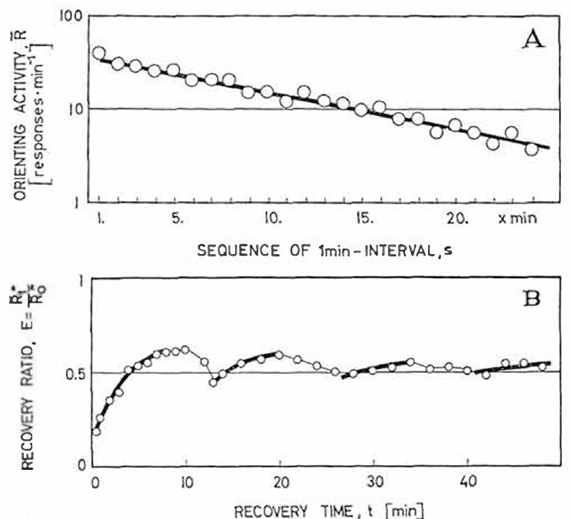
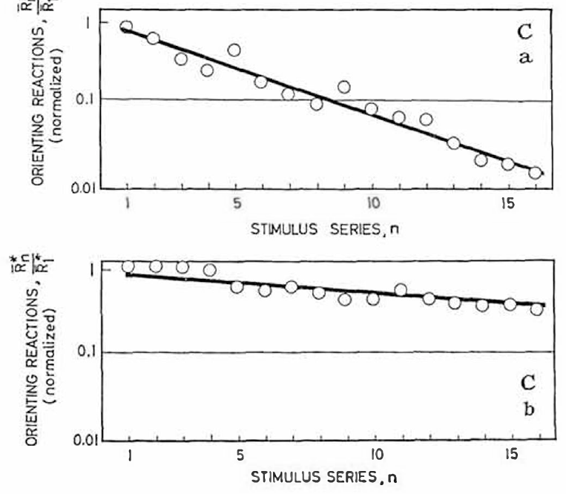
Habituation changes after pretectal damage
Habituation is a reduction in response during repeated presentations of a stimulus. In Ewert’s intact toads, orienting declined as a standard moving prey object was presented repeatedly. A pause allowed partial recovery, and repeated habituation series further reduced subsequent orienting.
After caudal thalamic and pretectal lesions, recovery could occur within approximately 5–10 minutes and the suppression accumulated much less across successive series. The same visual object remained capable of releasing movement after the normal persistent restraint was weakened.
The behavioral change connects the lesioned region to the time-dependent regulation of prey-catching. An intact toad stops orienting toward a dummy that keeps moving without being caught, whereas the lesioned toad keeps returning to it.
Ewert (1970), Fig. 5(Ca–Cb). Repeated habituation series suppress intact responses more than lesioned responses.
Ewert (1970), Fig. 5(A–B). Orienting declines with repetition and recovers after a pause.
Ewert (1970)
13
Notes:
Teaching transcript:
**Habituation** is a reduction in response during repeated presentations of a stimulus. In Ewert’s intact toads, orienting declined as a standard moving prey object was presented repeatedly. A pause allowed partial recovery, and repeated habituation series further reduced subsequent orienting.
After caudal thalamic and pretectal lesions, recovery could occur within approximately 5–10 minutes and the suppression accumulated much less across successive series. The same visual object remained capable of releasing movement after the normal persistent restraint was weakened.
The behavioral change connects the lesioned region to the time-dependent regulation of prey-catching. Habituation measured as turning behavior does not by itself distinguish retinal adaptation, tectal response changes, motivational changes and pretectal inhibition.
Response reduction must be measured against a prior response to the same kind of stimulus. Recovery after a pause distinguishes a reversible change from permanent loss of vision or movement, but multiple central and peripheral processes can contribute to a reversible behavioral decrement.
References:
Ewert JP (1970). Neural mechanisms of prey-catching and avoidance behavior in the toad (Bufo bufo L.). Brain, Behavior and Evolution 3(1–4):36–56. https://doi.org/10.1159/000125462
Ewert (1970), Fig. 5(A–B). Orienting declines with repetition and recovers after a pause.
Figure source: https://doi.org/10.1159/000125462
Ewert (1970), Fig. 5(Ca–Cb). Repeated habituation series suppress intact responses more than lesioned responses.
Figure source: https://doi.org/10.1159/000125462

Slide 20
Habituation is not fatigue or retinal adaptation
Three processes can make a repeated stimulus less effective. Sensory adaptation lowers the receptor or retinal response, motor fatigue lowers the capacity to move, and habituation weakens the central link between an intact sensory signal and an intact movement. Each predicts a different pattern of recovery and transfer.
Location specificity argues against fatigue. Newness cells that stop responding to an object crossing one region still respond when it enters another, so the output pathway stays available for a new target.
The two timescales in Ewert's toads carry different consequences. Within-series decline allows a toad to stop following one persistent object within a session, whereas suppression carried across series keeps it from resuming the same pursuit later. Pretectal damage weakened mainly the carried-over component.
Ewert (1970), Fig. 5(Ca–Cb). Repeated habituation series suppress intact responses more than lesioned responses.
Ewert (1970), Fig. 5(A–B). Orienting declines with repetition and recovers after a pause.
Ewert (1970); Ingle (1973)
13a
Notes:
Habituation on slide 13 is measured as fewer turns, and several different processes could reduce turning; separating them clarifies what the pretectal lesion changed.
Three candidate processes.
Adaptation acts at the sense organ or retina, fatigue acts at the muscles or motor output, and habituation acts on the central connection between them.
Each can be recognized by where the decrement transfers: fatigue would spread to every target, and adaptation would appear in the retinal signal itself.
Evidence from tectal cells.
Slide 15 defines newness cells by their decline when an object repeatedly crosses the same region, which means a new region still evokes a response.
A decrement tied to location cannot come from exhausted motor output, since the same output would serve the new location too.
Short and long components.
Ewert separated a decline within one series from a suppression that builds across series.
After lesions, recovery came within about 5 to 10 minutes and the build-up across series was much weaker, so the region contributes most to the lasting part of habituation.
References:
Ewert JP (1970). Neural mechanisms of prey-catching and avoidance behavior in the toad (Bufo bufo L.). Brain, Behavior and Evolution 3(1–4):36–56. https://doi.org/10.1159/000125462
Ingle D (1973). Disinhibition of tectal neurons by pretectal lesions in the frog. Science 180(4084):422–424. https://doi.org/10.1126/science.180.4084.422

Slide 21
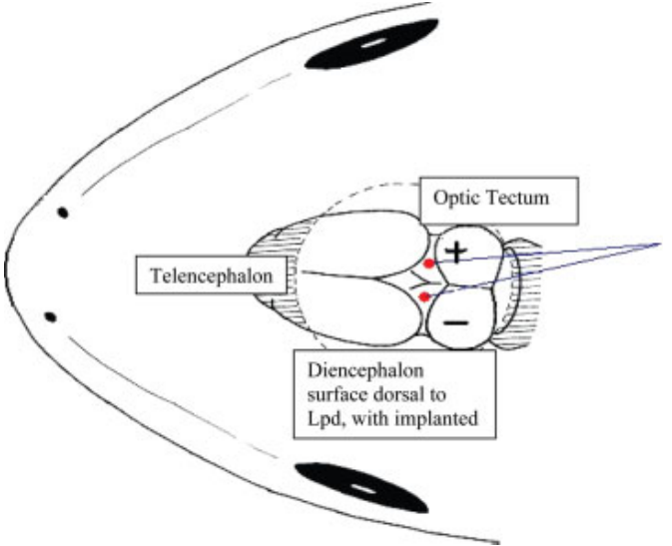
Forebrain removal can silence catching indirectly
The telencephalon, the anterior division of the forebrain, can regulate visually released behavior without supplying the entire catching motor sequence. Ewert removed the forebrain while sparing the thalamus and observed a pronounced reduction in prey-oriented responses.
Bilateral removal left animals unresponsive to prey dummies while avoidance increased. Additional damage to the pretectal and caudal thalamic region could restore disinhibited catching. Thus a missing forebrain did not necessarily remove the downstream capacity to execute prey-related movements.
The sequential interventions support regulation through an inhibitory intermediate, but the full lesion sequence also indicated additional forebrain influences. Forebrain activity normally restrains the pretectal region, so its removal leaves pretectal restraint of catching and pretectal drive of avoidance unopposed.
McConville & Laming (2007), Fig. 3. Lpd electrodes.
Ewert (1970); McConville & Laming (2007)
14
Notes:
Teaching transcript:
The **telencephalon**, the anterior division of the forebrain, can regulate visually released behavior without supplying the entire catching motor sequence. Ewert removed the forebrain while sparing the thalamus and observed a pronounced reduction in prey-oriented responses.
Bilateral removal left animals unresponsive to prey dummies while avoidance increased. Additional damage to the pretectal and caudal thalamic region could restore disinhibited catching. Thus a missing forebrain did not necessarily remove the downstream capacity to execute prey-related movements.
The sequential interventions support regulation through an inhibitory intermediate, but the full lesion sequence also indicated additional forebrain influences. These regional operations cannot establish a complete two-node circuit or identify the transmitter linking forebrain activity to pretectal restraint.
Removing a structure can suppress a behavior by releasing inhibition elsewhere, rather than by destroying the behavior’s output machinery. Recovery after a second lesion is especially informative about that possibility, although broad lesions leave the exact route of the regulation unresolved.
References:
Ewert JP (1970). Neural mechanisms of prey-catching and avoidance behavior in the toad (Bufo bufo L.). Brain, Behavior and Evolution 3(1–4):36–56. https://doi.org/10.1159/000125462
McConville J, Laming PR (2007). DC electrical stimulation of the pretectal thalamus and its effects on the feeding behavior of the toad (Bufo bufo). Developmental Neurobiology 67(7):875–883. https://doi.org/10.1002/dneu.20390
McConville & Laming (2007), Fig. 3. Lpd electrodes.
Figure source: https://doi.org/10.1002/dneu.20390

Slide 22
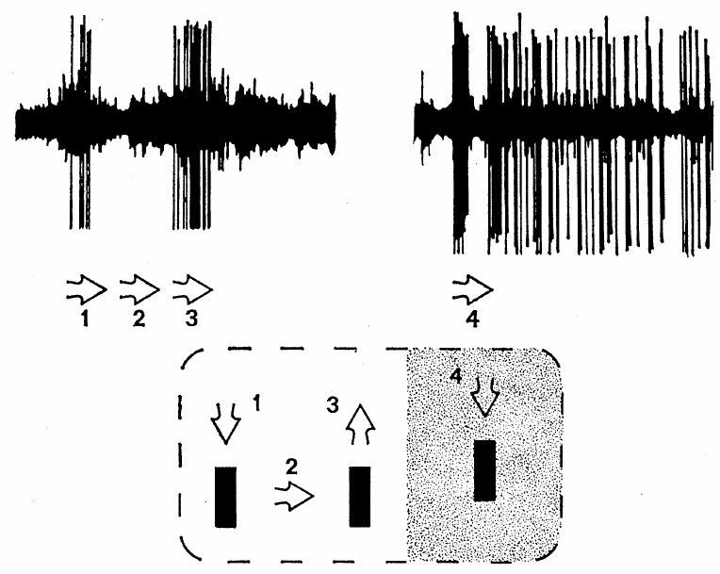
Newness cells respond selectively to recent motion
Ingle recorded newness cells, a functional class of tectal neurons whose responses normally diminish rapidly when an object repeatedly traverses the same visual region. In intact frogs, these cells commonly had receptive fields about 15–20° across.
A receptive field is the region of sensory space in which a stimulus changes a neuron’s activity. Normal newness cells could cease responding after one or two passages of a small object. This property differs from the repeated contrast responses of retinal class 3 fibers.
Ingle compared these responses after pretectal lesions associated with disinhibited pursuit. He proposed that the rapid habituation of these tectal cells underlies the frog's behavioral habituation when the same prey object moves repeatedly.
Ingle (1973), Fig. 1. A lesion-side tectal unit fires persistently to a moving and stopped object.
McConville & Laming (2007), Fig. 3. Lpd electrodes.
Ingle (1973); McConville & Laming (2007)
15
Notes:
Teaching transcript:
Ingle recorded **newness cells**, a functional class of tectal neurons whose responses normally diminish rapidly when an object repeatedly traverses the same visual region. In intact frogs, these cells commonly had receptive fields about 15–20° across.
A **receptive field** is the region of sensory space in which a stimulus changes a neuron’s activity. Normal newness cells could cease responding after one or two passages of a small object. This property differs from the repeated contrast responses of retinal class 3 fibers.
Ingle compared these responses after pretectal lesions associated with disinhibited pursuit. The category describes measured visual response properties, not a molecularly defined cell type or a demonstrated neurotransmitter identity shared by every cell.
A receptive field is defined experimentally by moving a stimulus through visual space while recording the cell. A rapidly habituating tectal unit and a retinal axon can both respond to a small dark object, so object preference alone is insufficient to identify the recording.
The anatomical comparison from McConville and Laming locates homologous regions in a common toad; it is not an anatomical reconstruction of the frog operated on by Ingle.
Ingle selected frogs with disinhibited pursuit after knife cuts or suction near the pretectal region, with some operations also interrupting commissural connections. The result applies to that selected syndrome, rather than to every pretectal operation.
References:
Ingle D (1973). Disinhibition of tectal neurons by pretectal lesions in the frog. Science 180(4084):422–424. https://doi.org/10.1126/science.180.4084.422
McConville J, Laming PR (2007). DC electrical stimulation of the pretectal thalamus and its effects on the feeding behavior of the toad (Bufo bufo). Developmental Neurobiology 67(7):875–883. https://doi.org/10.1002/dneu.20390
Ingle (1973), Fig. 1. A lesion-side tectal unit fires persistently to a moving and stopped object.
Figure source: https://doi.org/10.1126/science.180.4084.422
McConville & Laming (2007), Fig. 3. Lpd electrodes.
Figure source: https://doi.org/10.1002/dneu.20390

Slide 23
Disinhibited tectal cells keep firing after motion stops
Ingle presented a black square about 4° across moving at approximately 10°/s on a screen 20 cm from the frog. In animals with behaviorally effective pretectal lesions, tectal units could produce prolonged activity unlike normal rapidly habituating newness cells.
A spot that stopped within the receptive field could evoke a discharge lasting approximately 5–10 seconds. In some cells, the highest firing occurred 2–3 seconds after the stimulus stopped, rather than immediately at motion onset or termination.
The persistence separates response regulation from simple tracking of instantaneous motion. In the lesioned frog a bug-like object no longer fades from the tectal response, paralleling the frog's failure to ignore moving prey-like stimuli after the operation.
Ingle (1973), Fig. 1. A lesion-side tectal unit fires persistently to a moving and stopped object.
McConville & Laming (2007), Fig. 3. Lpd electrodes.
Ingle (1973); McConville & Laming (2007)
16
Notes:
Teaching transcript:
Ingle presented a black square about 4° across moving at approximately 10°/s on a screen 20 cm from the frog. In animals with behaviorally effective pretectal lesions, tectal units could produce prolonged activity unlike normal rapidly habituating newness cells.
A spot that stopped within the receptive field could evoke a discharge lasting approximately 5–10 seconds. In some cells, the highest firing occurred 2–3 seconds after the stimulus stopped, rather than immediately at motion onset or termination.
The persistence separates response regulation from simple tracking of instantaneous motion. The lesion results support a normal pretectal restraint on tectal responsiveness, but they do not identify whether the long discharge is generated by intrinsic currents or recurrent network activity.
A delayed peak after motion stops cannot be interpreted as a precise neural report of the object’s current speed. Ingle also observed exceptionally intense, seizure-like activity in some preparations. Such pathological responses are evidence of disrupted regulation and should not be described as normal predator coding.
The anatomical comparison from McConville and Laming locates homologous regions in a common toad; it is not an anatomical reconstruction of the frog operated on by Ingle.
References:
Ingle D (1973). Disinhibition of tectal neurons by pretectal lesions in the frog. Science 180(4084):422–424. https://doi.org/10.1126/science.180.4084.422
McConville J, Laming PR (2007). DC electrical stimulation of the pretectal thalamus and its effects on the feeding behavior of the toad (Bufo bufo). Developmental Neurobiology 67(7):875–883. https://doi.org/10.1002/dneu.20390
Ingle (1973), Fig. 1. A lesion-side tectal unit fires persistently to a moving and stopped object.
Figure source: https://doi.org/10.1126/science.180.4084.422
McConville & Laming (2007), Fig. 3. Lpd electrodes.
Figure source: https://doi.org/10.1002/dneu.20390

Slide 24
Pretectal damage can enlarge a tectal receptive field
After behaviorally effective pretectal lesions, Ingle recorded tectal receptive fields approximately 30° across or larger, compared with the usual 15–20° range of normal newness cells. Some recorded fields enlarged from about 15° to 30° during the observation.
The lesion-side example contains a broad field with a particularly excitable zone, and movement of a small object could evoke activity that persisted when motion stopped. Other cells remained spatially responsive but discharged more strongly or for longer than normal.
Receptive-field enlargement is consistent with removal of inhibition that normally limits effective visual input. A wider field allows each cell to respond to objects across more of visual space, so a single moving stimulus can drive a larger set of tectal neurons.
Ingle (1973), Fig. 1. A lesion-side tectal unit fires persistently to a moving and stopped object.
McConville & Laming (2007), Fig. 3. Lpd electrodes.
Ingle (1973); McConville & Laming (2007)
17
Notes:
Teaching transcript:
After behaviorally effective pretectal lesions, Ingle recorded tectal receptive fields approximately 30° across or larger, compared with the usual 15–20° range of normal newness cells. Some recorded fields enlarged from about 15° to 30° during the observation.
The lesion-side example contains a broad field with a particularly excitable zone, and movement of a small object could evoke activity that persisted when motion stopped. Other cells remained spatially responsive but discharged more strongly or for longer than normal.
Receptive-field enlargement is consistent with removal of inhibition that normally limits effective visual input. Extracellular spike recordings, which detect neuronal action potentials outside the cell, do not establish the membrane conductance or circuit connection responsible for the enlargement.
A larger functional receptive field need not mean that new anatomical retinal connections appeared during the experiment. Previously ineffective inputs may become capable of producing spikes after inhibition is lost. The recording tests responsiveness rather than directly counting synapses.
The anatomical comparison from McConville and Laming locates homologous regions in a common toad; it is not an anatomical reconstruction of the frog operated on by Ingle.
References:
Ingle D (1973). Disinhibition of tectal neurons by pretectal lesions in the frog. Science 180(4084):422–424. https://doi.org/10.1126/science.180.4084.422
McConville J, Laming PR (2007). DC electrical stimulation of the pretectal thalamus and its effects on the feeding behavior of the toad (Bufo bufo). Developmental Neurobiology 67(7):875–883. https://doi.org/10.1002/dneu.20390
Ingle (1973), Fig. 1. A lesion-side tectal unit fires persistently to a moving and stopped object.
Figure source: https://doi.org/10.1126/science.180.4084.422
McConville & Laming (2007), Fig. 3. Lpd electrodes.
Figure source: https://doi.org/10.1002/dneu.20390

Slide 25
Surround inhibition makes large objects weak stimuli
A receptive field's edge marks where excitation from a stimulus stops outweighing inhibition. Input beyond the edge still reaches the cell but stays below spike threshold, and a large object covering center and surround recruits that inhibition strongly.
Removing the pretectal contribution shifts this balance at every point. Weak peripheral inputs now cross threshold, so the effective field widens, and a large object no longer engages a suppressing surround. In toads, Laming and Ewert measured fields growing from about 20–25° to 40–60° after pretectal and dorsal thalamic cuts.
Ingle (1973), Fig. 1. A lesion-side tectal unit fires persistently to a moving and stopped object.
Field organization therefore sets which objects count as prey for a tectal cell. A hand or a shoe box covers a broad region and, in an intact animal, drives inhibition along with excitation; after the lesion the same object excites over a wide area, matching attacks on large, inappropriate targets.
McConville & Laming (2007), Fig. 3. Lpd electrodes.
Ingle (1973); Laming & Ewert (1983); Ewert (1970)
17a
Notes:
Slide 17 reports that pretectal damage enlarges tectal fields; the balance of excitation and inhibition explains both the enlargement and its behavioral effect.
Where a field ends.
A field boundary is functional: inputs from farther out still arrive, but they are outweighed by inhibition and produce no spikes.
This view predicts that weakening inhibition should move the boundary outward without any new anatomical connection.
The same change in two species.
Ingle saw frog fields grow from the usual 15 to 20 degrees to 30 degrees or more.
Slide 21 adds the toad measurement, with some fields expanding from about 20 to 25 degrees to 40 to 60 degrees after the cut.
Consequence for target choice.
A large object normally recruits inhibition from a wide surround, which keeps its excitatory effect small and fits the low prey value of large discs on slide 2.
Without that surround the large object becomes an effective stimulus, consistent with the snapping at hands and boxes on slide 9.
References:
Ingle D (1973). Disinhibition of tectal neurons by pretectal lesions in the frog. Science 180(4084):422–424. https://doi.org/10.1126/science.180.4084.422
Laming PR, Ewert JP (1983). The effects of pretectal lesions on neuronal, sustained potential shift and electroencephalographic responses of the toad tectum to presentation of a visual stimulus. Comparative Biochemistry and Physiology Part A: Physiology 76(2):247–252. https://doi.org/10.1016/0300-9629(83)90322-5
Ewert JP (1970). Neural mechanisms of prey-catching and avoidance behavior in the toad (Bufo bufo L.). Brain, Behavior and Evolution 3(1–4):36–56. https://doi.org/10.1159/000125462

Slide 26
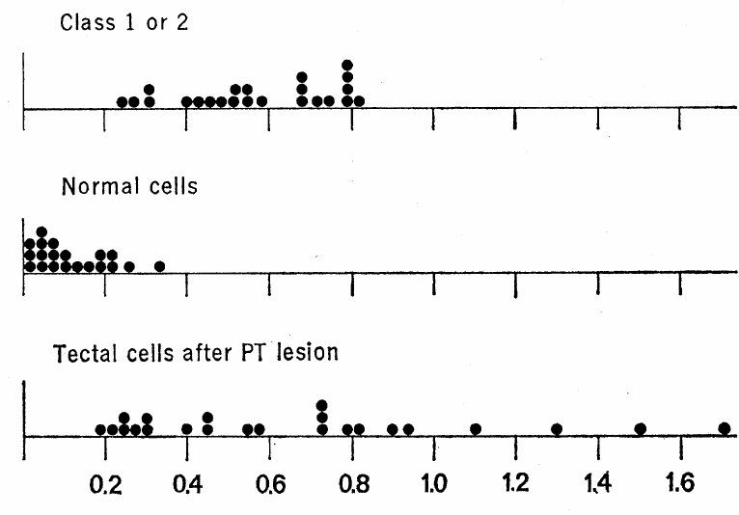
The lesion alters tectal habituation more than retinal input
Ingle quantified recovery after a 10-second pause relative to spike activity during a 60-second comparison interval. The habituation ratio expresses how much responsiveness remains after repeated stimulation and a short recovery period.
Retinal class 1 and class 2 fibers generally had ratios between 25% and 80%. Normal tectal newness cells were below 25%, and most were below 10%. After pretectal lesions, tectal ratios shifted toward the retinal range, whereas retinal fibers did not acquire a corresponding lesion-dependent change.
The retinal comparison argues against a purely peripheral explanation for the loss of tectal habituation. The suppression that normally makes tectal cells ignore a repeated object is therefore added centrally, between the retinal input and the tectal output.
Ingle (1973), Fig. 2. Habituation-ratio distributions in retinal fibers and tectal cells.
McConville & Laming (2007), Fig. 3. Lpd electrodes.
Ingle (1973); McConville & Laming (2007)
18
Notes:
Teaching transcript:
Ingle quantified recovery after a 10-second pause relative to spike activity during a 60-second comparison interval. The **habituation ratio** expresses how much responsiveness remains after repeated stimulation and a short recovery period.
Retinal class 1 and class 2 fibers generally had ratios between 25% and 80%. Normal tectal newness cells were below 25%, and most were below 10%. After pretectal lesions, tectal ratios shifted toward the retinal range, whereas retinal fibers did not acquire a corresponding lesion-dependent change.
The retinal comparison argues against a purely peripheral explanation for the loss of tectal habituation. It supports central regulation of responsiveness, while leaving open the contributions of different pretectal connections and local tectal inhibitory circuitry.
The ratio is a measurement defined by the original experiment, not a direct measure of an inhibitory synaptic current. Retinal fibers retain repeated responsiveness in both conditions, while the normal additional suppression at the tectal level is weakened after the lesion.
The anatomical comparison from McConville and Laming locates homologous regions in a common toad; it is not an anatomical reconstruction of the frog operated on by Ingle.
References:
Ingle D (1973). Disinhibition of tectal neurons by pretectal lesions in the frog. Science 180(4084):422–424. https://doi.org/10.1126/science.180.4084.422
McConville J, Laming PR (2007). DC electrical stimulation of the pretectal thalamus and its effects on the feeding behavior of the toad (Bufo bufo). Developmental Neurobiology 67(7):875–883. https://doi.org/10.1002/dneu.20390
Ingle (1973), Fig. 2. Habituation-ratio distributions in retinal fibers and tectal cells.
Figure source: https://doi.org/10.1126/science.180.4084.422
McConville & Laming (2007), Fig. 3. Lpd electrodes.
Figure source: https://doi.org/10.1002/dneu.20390

Slide 27
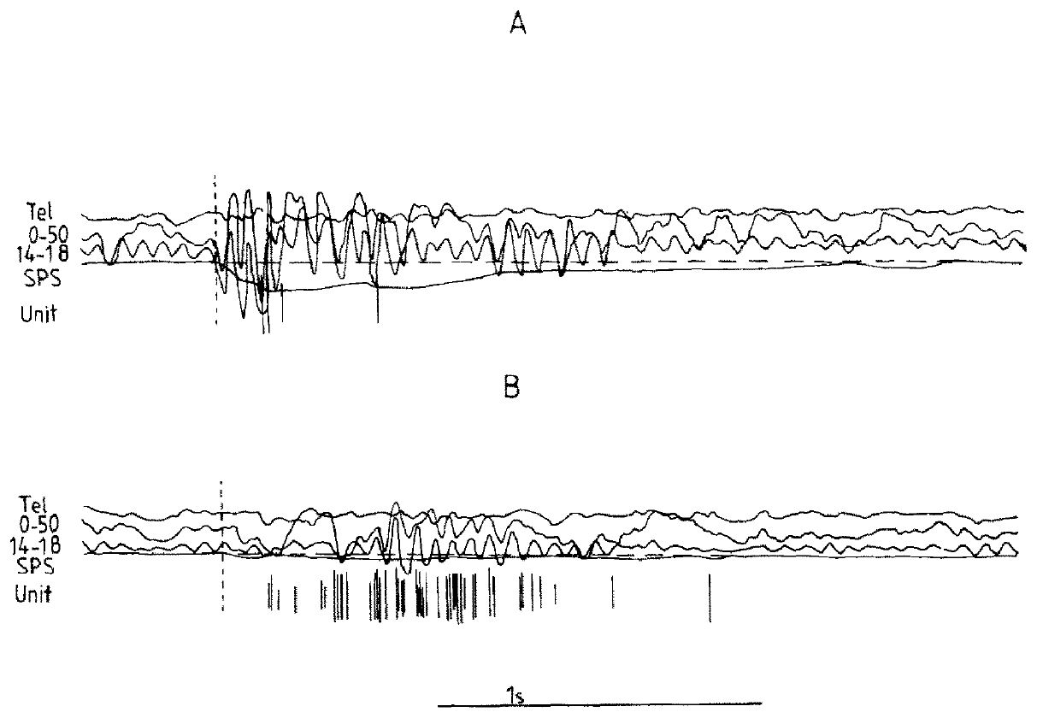
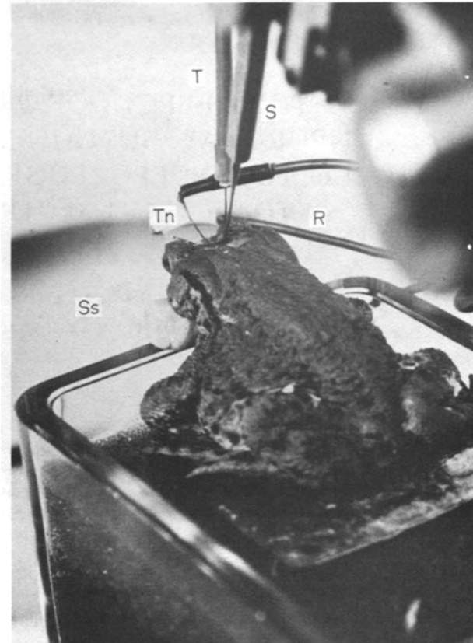
A same-unit experiment links lesion and visual response
Laming and Ewert recorded tectal visual units while monitoring slower electrical signals in the same toad. Their T5(2) designation identifies units with prey-related configuration sensitivity; it is a physiological classification rather than a genetically labeled population.
They compared a 1.8° × 15° worm-like rectangle, a 15° × 1.8° antiworm and a 15° square moving at 22°/s. A knife cut disrupted ipsilateral pretectal and dorsal thalamic connections while the electrode remained in place, and recordings resumed after approximately 15–30 minutes.
Maintaining the unit provides a stronger comparison than replacing it with an unrelated post-lesion cell. Each recorded neuron serves as its own control, so a change in its response to the same three objects reflects the cut rather than differences between cells.
Laming & Ewert (1983), Fig. 1. Recording preparation.
Laming & Ewert (1983), Fig. 2(A–B). Unit, EEG and slow potentials before and after lesion.
Laming & Ewert (1983)
19
Notes:
Teaching transcript:
Laming and Ewert recorded tectal visual units while monitoring slower electrical signals in the same toad. Their **T5(2)** designation identifies units with prey-related configuration sensitivity; it is a physiological classification rather than a genetically labeled population.
They compared a 1.8° × 15° worm-like rectangle, a 15° × 1.8° antiworm and a 15° square moving at 22°/s. A knife cut disrupted ipsilateral pretectal and dorsal thalamic connections while the electrode remained in place, and recordings resumed after approximately 15–30 minutes.
Maintaining the unit provides a stronger comparison than replacing it with an unrelated post-lesion cell. Only preparations retaining suitable recordings support that comparison, and the knife cut still affects a regional set of connections.
Holding the recording position reduces uncertainty about whether a changed response is due to sampling a different unit. The stimulus dimensions separate configuration from mere visibility, while the post-cut waiting interval reduces immediate recording disturbance without making the lesion anatomically selective.
References:
Laming PR, Ewert JP (1983). The effects of pretectal lesions on neuronal, sustained potential shift and electroencephalographic responses of the toad tectum to presentation of a visual stimulus. Comparative Biochemistry and Physiology Part A: Physiology 76(2):247–252. https://doi.org/10.1016/0300-9629(83)90322-5
Laming & Ewert (1983), Fig. 2(A–B). Unit, EEG and slow potentials before and after lesion.
Figure source: https://doi.org/10.1016/0300-9629(83)90322-5
Laming & Ewert (1983), Fig. 1. Recording preparation.
Figure source: https://doi.org/10.1016/0300-9629(83)90322-5

Slide 28
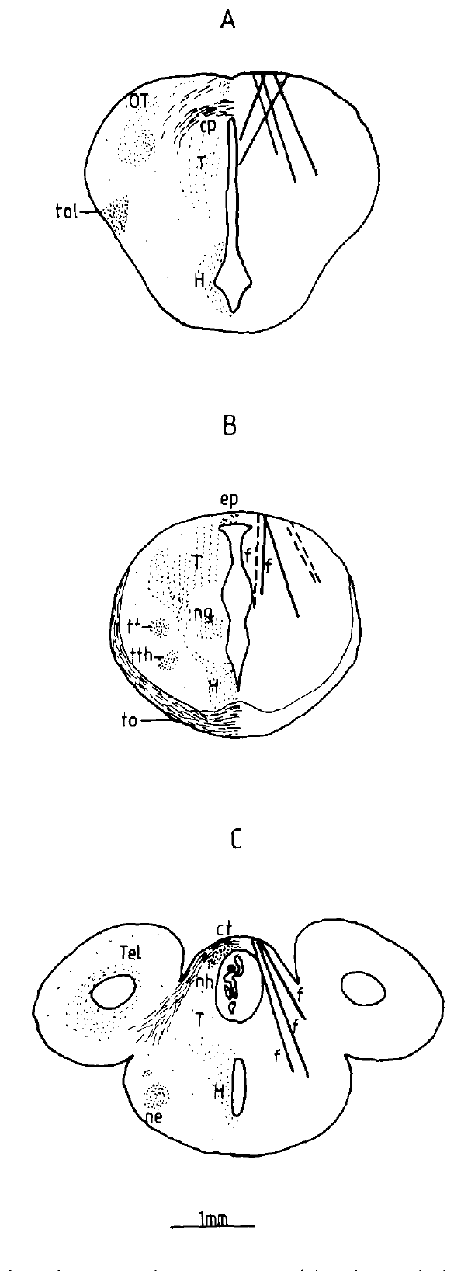
Spikes, EEG and slow potentials measure different activity
A spike recording detects action potentials from a unit, whereas an electroencephalogram, or EEG, records aggregate electrical activity over a broader neuronal population. Laming and Ewert also measured a sustained potential shift, a slower change in extracellular voltage associated with visual stimulation.
Their simultaneous traces compare tectal spikes, tectal EEG bands and slow potentials before and after a pretectal lesion. The EEG included a 14–18 Hz band and a wider 0–50 Hz band, while slow shifts were recorded separately from the rapid unit response.
These signals depend on different spatial and temporal properties of electrical activity. Spikes report the output of one neuron, whereas slow fields sum synaptic currents across many cells, so a stronger single-unit discharge can coexist with a smaller population field.
Laming & Ewert (1983), Fig. 3(A–C). Lesion sites (1 mm).
Laming & Ewert (1983), Fig. 2(A–B). Unit, EEG and slow potentials before and after lesion.
Laming & Ewert (1983)
20
Notes:
Teaching transcript:
A **spike recording** detects action potentials from a unit, whereas an **electroencephalogram**, or EEG, records aggregate electrical activity over a broader neuronal population. Laming and Ewert also measured a **sustained potential shift**, a slower change in extracellular voltage associated with visual stimulation.
Their simultaneous traces compare tectal spikes, tectal EEG bands and slow potentials before and after a pretectal lesion. The EEG included a 14–18 Hz band and a wider 0–50 Hz band, while slow shifts were recorded separately from the rapid unit response.
These signals depend on different spatial and temporal properties of electrical activity. A stronger single-unit discharge can coexist with a smaller population field; field amplitude cannot be read as the firing rate of every neuron in the region.
Extracellular voltage reflects currents distributed through tissue and depends on their geometry and coordination. Spikes count discrete events from a recorded unit. The simultaneous measurements therefore test related but distinct consequences of the same lesion and visual stimulus.
References:
Laming PR, Ewert JP (1983). The effects of pretectal lesions on neuronal, sustained potential shift and electroencephalographic responses of the toad tectum to presentation of a visual stimulus. Comparative Biochemistry and Physiology Part A: Physiology 76(2):247–252. https://doi.org/10.1016/0300-9629(83)90322-5
Laming & Ewert (1983), Fig. 2(A–B). Unit, EEG and slow potentials before and after lesion.
Figure source: https://doi.org/10.1016/0300-9629(83)90322-5
Laming & Ewert (1983), Fig. 3(A–C). Lesion sites (1 mm).
Figure source: https://doi.org/10.1016/0300-9629(83)90322-5

Slide 29
Immobilized toads fire more strongly after the lesion
In immobilized toads, Laming and Ewert compared responses of maintained T5(2) units before and after disruption of pretectal and dorsal thalamic connections. A worm-like rectangle moved at 22°/s through the unit’s visual receptive field.
The reported response frequency increased from approximately 16.1 to 39.4 spikes/s, and the response duration increased from approximately 0.96 to 1.54 seconds. Some fields expanded from approximately 20–25° to 40–60°. The lesion therefore changed both the strength and spatial extent of effective visual input.
These measurements support removal of a restraining influence on tectal responsiveness. With the toad immobilized, the increases arise within the visual pathway itself and not from additional prey-catching movements during the recording.
Laming & Ewert (1983), Fig. 3(A–C). Lesion sites (1 mm).
Laming & Ewert (1983), Fig. 2(A–B). Unit, EEG and slow potentials before and after lesion.
Laming & Ewert (1983)
21
Notes:
Teaching transcript:
In immobilized toads, Laming and Ewert compared responses of maintained T5(2) units before and after disruption of pretectal and dorsal thalamic connections. A worm-like rectangle moved at 22°/s through the unit’s visual receptive field.
The reported response frequency increased from approximately 16.1 to 39.4 spikes/s, and the response duration increased from approximately 0.96 to 1.54 seconds. Some fields expanded from approximately 20–25° to 40–60°. The lesion therefore changed both the strength and spatial extent of effective visual input.
These measurements support removal of a restraining influence on tectal responsiveness. Because the toad was immobilized, the increases are not simply the consequence of additional prey-catching movements during the recording, but the precise inhibitory connection remains unresolved.
Immobilization permits recording without the large movement artifacts of a freely moving animal. It also changes the behavioral preparation. Numerical changes obtained in that condition should not automatically be transferred to the firing rates of neurons during unrestricted prey capture.
References:
Laming PR, Ewert JP (1983). The effects of pretectal lesions on neuronal, sustained potential shift and electroencephalographic responses of the toad tectum to presentation of a visual stimulus. Comparative Biochemistry and Physiology Part A: Physiology 76(2):247–252. https://doi.org/10.1016/0300-9629(83)90322-5
Laming & Ewert (1983), Fig. 2(A–B). Unit, EEG and slow potentials before and after lesion.
Figure source: https://doi.org/10.1016/0300-9629(83)90322-5
Laming & Ewert (1983), Fig. 3(A–C). Lesion sites (1 mm).
Figure source: https://doi.org/10.1016/0300-9629(83)90322-5

Slide 30
Population potentials can shrink while spikes increase
In the same immobilized preparations, pretectal lesions increased the frequency and duration of tectal unit responses but reduced the amplitude of sustained potential shifts and EEG responses. The measurements diverged despite being collected during the same kind of visual stimulation.
An extracellular population field depends on the location, timing and orientation of contributing currents. It is therefore possible for a recorded unit to produce more spikes while the aggregate voltage change becomes smaller. The wider 0–50 Hz EEG and the 14–18 Hz band provide population measurements rather than unit counts.
The experiment rejects a simple equivalence between field amplitude and neuronal excitation. For prey capture the unit discharge is the more relevant measure, since tectal spikes travel to the motor circuits that aim orienting and snapping.
Laming & Ewert (1983), Fig. 3(A–C). Lesion sites (1 mm).
Laming & Ewert (1983), Fig. 2(A–B). Unit, EEG and slow potentials before and after lesion.
Laming & Ewert (1983)
22
Notes:
Teaching transcript:
In the same immobilized preparations, pretectal lesions increased the frequency and duration of tectal unit responses but reduced the amplitude of sustained potential shifts and EEG responses. The measurements diverged despite being collected during the same kind of visual stimulation.
An extracellular population field depends on the location, timing and orientation of contributing currents. It is therefore possible for a recorded unit to produce more spikes while the aggregate voltage change becomes smaller. The wider 0–50 Hz EEG and the 14–18 Hz band provide population measurements rather than unit counts.
The experiment rejects a simple equivalence between field amplitude and neuronal excitation. It does not independently establish which changes in synchrony, current geometry or ionic redistribution caused the reduced population signals.
A smaller field does not establish that every tectal neuron is less active. Conversely, the increased activity of the maintained unit does not establish that the entire population is more active in a coordinated way. The cellular and population responses must remain separate observations.
References:
Laming PR, Ewert JP (1983). The effects of pretectal lesions on neuronal, sustained potential shift and electroencephalographic responses of the toad tectum to presentation of a visual stimulus. Comparative Biochemistry and Physiology Part A: Physiology 76(2):247–252. https://doi.org/10.1016/0300-9629(83)90322-5
Laming & Ewert (1983), Fig. 2(A–B). Unit, EEG and slow potentials before and after lesion.
Figure source: https://doi.org/10.1016/0300-9629(83)90322-5
Laming & Ewert (1983), Fig. 3(A–C). Lesion sites (1 mm).
Figure source: https://doi.org/10.1016/0300-9629(83)90322-5

Slide 31
Field amplitude depends on synchrony across cells
An extracellular field becomes large only when many cells pass current in the same direction at the same moment. If their synaptic currents are spread out in time, contributions overlap and partly cancel, so the summed voltage stays small even when each cell is active.
Inhibitory networks commonly impose shared timing, silencing many targets together and releasing them together. Removing pretectal restraint could free tectal neurons to fire longer and more independently, raising unit discharge while weakening the coordinated currents behind sustained shifts and EEG responses.
The durations measured in the same preparations fit this reading. A unit response stretched from about 0.96 to 1.54 seconds spreads its currents over a longer window, so greater total activity can still produce a smaller peak in the population field.
Laming & Ewert (1983), Fig. 2(A–B). Unit, EEG and slow potentials before and after lesion.
Laming & Ewert (1983)
22a
Notes:
Slide 22 reports opposite changes in spikes and fields; the principle that field size depends on synchronous current offers a mechanism for that divergence.
What makes a field large.
Field potentials are dominated by synaptic currents in many cells, and they add up only when those currents line up in time and orientation.
Two cells with opposite or staggered currents largely cancel at the electrode, even though each is active.
How inhibition can synchronize.
An inhibitory input that reaches many neurons at once tends to align when they stop and restart firing.
Losing such an input could leave each tectal neuron freer to fire on its own schedule, which raises spike counts in single units while reducing coordination across the population.
This is a proposed explanation consistent with the recordings, not a measured change in synchrony.
The duration evidence.
Slide 21 reports longer unit responses after the cut in the immobilized toads.
Activity spread over a longer time produces a lower peak in a summed signal, which fits the smaller sustained shifts on slide 22.
References:
Laming PR, Ewert JP (1983). The effects of pretectal lesions on neuronal, sustained potential shift and electroencephalographic responses of the toad tectum to presentation of a visual stimulus. Comparative Biochemistry and Physiology Part A: Physiology 76(2):247–252. https://doi.org/10.1016/0300-9629(83)90322-5

Slide 32
Freely moving toads mainly prolong the response
Laming and Ewert also used chronically mounted electrodes in freely moving toads. In animals whose lesions produced disinhibited prey-catching, they compared responses to worm-like and antiworm objects while behavior was available rather than prevented.
Response duration increased from approximately 0.41 to 1.24 seconds for the worm-like stimulus and from approximately 0.51 to 1.51 seconds for the antiworm. In contrast to the immobilized preparation, the frequency of unit firing was not appreciably increased.
The common lesion effect was a longer period of responsiveness, while firing-rate effects depended on preparation. Sustained activity can therefore contribute to inappropriate catching without requiring the same increase in spikes/s reported in immobilized animals.
Laming & Ewert (1983), Fig. 3(A–C). Lesion sites (1 mm).
Laming & Ewert (1983), Fig. 2(A–B). Unit, EEG and slow potentials before and after lesion.
Laming & Ewert (1983)
23
Notes:
Teaching transcript:
Laming and Ewert also used chronically mounted electrodes in freely moving toads. In animals whose lesions produced disinhibited prey-catching, they compared responses to worm-like and antiworm objects while behavior was available rather than prevented.
Response duration increased from approximately 0.41 to 1.24 seconds for the worm-like stimulus and from approximately 0.51 to 1.51 seconds for the antiworm. In contrast to the immobilized preparation, the frequency of unit firing was not appreciably increased.
The common lesion effect was a longer period of responsiveness, while firing-rate effects depended on preparation. Sustained activity can therefore contribute to inappropriate catching without requiring the same increase in spikes/s reported in immobilized animals; correlation with movement alone does not prove a unit commands the response.
A longer response means that spikes remain available to downstream circuits for more time, even if the rate within that response is unchanged. The freely moving and immobilized conditions test different states of the animal, so their results are complementary rather than interchangeable.
References:
Laming PR, Ewert JP (1983). The effects of pretectal lesions on neuronal, sustained potential shift and electroencephalographic responses of the toad tectum to presentation of a visual stimulus. Comparative Biochemistry and Physiology Part A: Physiology 76(2):247–252. https://doi.org/10.1016/0300-9629(83)90322-5
Laming & Ewert (1983), Fig. 2(A–B). Unit, EEG and slow potentials before and after lesion.
Figure source: https://doi.org/10.1016/0300-9629(83)90322-5
Laming & Ewert (1983), Fig. 3(A–C). Lesion sites (1 mm).
Figure source: https://doi.org/10.1016/0300-9629(83)90322-5

Slide 33
Anti-worm responses lose their normal restriction
In the freely moving toads that became disinhibited, the tectal units lost their previous distinction between worm-like and antiworm configurations. Both 1.8° × 15° and 15° × 1.8° objects could evoke extended activity after the lesion.
The antiworm response duration increased to approximately 1.51 seconds, and the frequency of tectal EEG activity associated with antiworm presentation rose from approximately 15.2 to 18.8 Hz. Toads could orient or snap toward configurations that previously failed to release suitable prey-catching.
The neuronal and behavioral changes support a contribution of pretectal connections to selective response restriction. Once antiworm bars drive tectal units as worm-like bars do, the toad's catching circuits receive no signal that separates prey from nonprey configurations.
Laming & Ewert (1983), Fig. 3(A–C). Lesion sites (1 mm).
Laming & Ewert (1983), Fig. 2(A–B). Unit, EEG and slow potentials before and after lesion.
Laming & Ewert (1983)
24
Notes:
Teaching transcript:
In the freely moving toads that became disinhibited, the tectal units lost their previous distinction between worm-like and antiworm configurations. Both 1.8° × 15° and 15° × 1.8° objects could evoke extended activity after the lesion.
The antiworm response duration increased to approximately 1.51 seconds, and the frequency of tectal EEG activity associated with antiworm presentation rose from approximately 15.2 to 18.8 Hz. Toads could orient or snap toward configurations that previously failed to release suitable prey-catching.
The neuronal and behavioral changes support a contribution of pretectal connections to selective response restriction. An increased EEG frequency is a population rhythm measurement, distinct from spikes/s, and it does not identify a particular inhibitory transmitter or direct pretectal synapse.
The paper compared the two object configurations in a preparation where movements were recorded. The loss of discrimination is not equivalent to an increase in every measured electrical signal. The duration, EEG rhythm and amplitude have separate meanings and do not supply a complete causal chain on their own.
References:
Laming PR, Ewert JP (1983). The effects of pretectal lesions on neuronal, sustained potential shift and electroencephalographic responses of the toad tectum to presentation of a visual stimulus. Comparative Biochemistry and Physiology Part A: Physiology 76(2):247–252. https://doi.org/10.1016/0300-9629(83)90322-5
Laming & Ewert (1983), Fig. 2(A–B). Unit, EEG and slow potentials before and after lesion.
Figure source: https://doi.org/10.1016/0300-9629(83)90322-5
Laming & Ewert (1983), Fig. 3(A–C). Lesion sites (1 mm).
Figure source: https://doi.org/10.1016/0300-9629(83)90322-5

Slide 34
More firing need not mean lost discrimination
Laming and Ewert reconstructed lesions from transverse sections and compared their positions with changes in visual responses. Lesions producing disinhibited catching lay near the relevant pretectal and dorsal thalamic connections, while other cuts could increase unit activity without the same behavioral syndrome.
More extreme lateral cuts increased firing by approximately 20–350% in some recordings but did not remove configuration selectivity. In freely moving animals, lesions closer to the midline could fail to cause the same motor disinhibition, despite altering the recording.
Excitability, the tendency to produce spikes, and selectivity, the distinction between stimulus configurations, are different properties. Cuts that raised firing but kept selectivity did not release catching, so target choice follows the tectal distinction between configurations.
Laming & Ewert (1983), Fig. 3(A–C). Lesion sites (1 mm).
Laming & Ewert (1983)
25
Notes:
Teaching transcript:
Laming and Ewert reconstructed lesions from transverse sections and compared their positions with changes in visual responses. Lesions producing disinhibited catching lay near the relevant pretectal and dorsal thalamic connections, while other cuts could increase unit activity without the same behavioral syndrome.
More extreme lateral cuts increased firing by approximately 20–350% in some recordings but did not remove configuration selectivity. In freely moving animals, lesions closer to the midline could fail to cause the same motor disinhibition, despite altering the recording.
**Excitability**, the tendency to produce spikes, and **selectivity**, the distinction between stimulus configurations, are different properties. A regional increase in responsiveness does not establish that a neuron has lost the filtering necessary to reject nonprey.
The anatomical comparison prevents reducing the experiment to a single statement that lesions increase activity. Different cuts can affect the response strength or the stimulus distinction differently. Behavioral disinhibition requires the appropriate pattern of changed input–output relationships, not merely more recorded spikes.
References:
Laming PR, Ewert JP (1983). The effects of pretectal lesions on neuronal, sustained potential shift and electroencephalographic responses of the toad tectum to presentation of a visual stimulus. Comparative Biochemistry and Physiology Part A: Physiology 76(2):247–252. https://doi.org/10.1016/0300-9629(83)90322-5
Laming & Ewert (1983), Fig. 3(A–C). Lesion sites (1 mm).
Figure source: https://doi.org/10.1016/0300-9629(83)90322-5

Slide 35
Delayed inhibition keeps tectal responses brief
Inhibition that arrives after excitation shapes the duration of a response more than its onset. The first spikes to a moving object escape suppression, and an inhibitory input arriving one or more synaptic steps later ends the discharge. Remove that input and onset is unchanged while firing continues.
Pretectal conditioning suppressed the optic-nerve-evoked wave most strongly at a lead of about 17–25 ms, so pretectal inhibition reaches the tectum tens of milliseconds late, a timing suited to ending responses rather than preventing them.
Prolonged discharge was the lesion effect shared across species and preparations: 5–10 second discharges in frog tectal cells, and worm-like response durations rising from about 0.41 to 1.24 seconds in freely moving toads whose firing rate barely changed. Duration is the variable a delayed inhibitory input controls.
Laming & Ewert (1983), Fig. 3(A–C). Lesion sites (1 mm).
Ingle (1973); Laming & Ewert (1983); Schwippert et al. (1995)
25a
Notes:
Several slides report longer tectal responses after pretectal damage; the timing of pretectal inhibition explains why duration, more than onset or peak rate, is the consistent change.
Timing decides what inhibition controls.
Excitation from the retina reaches tectal cells first, so the beginning of a response is set before any later-arriving inhibition can act.
An inhibitory signal that comes later can only shorten the response, and its loss can only lengthen it.
Evidence for a delay.
Slide 31 shows the strongest suppression when the pretectal pulse comes about 17 to 25 milliseconds ahead of the optic-nerve pulse.
A pretectal effect that needs that much lead time fits a pathway with at least one intervening step.
The common lesion effect.
Ingle's frog units on slide 16 discharged for 5 to 10 seconds after a spot stopped.
In Laming and Ewert's freely moving toads on slide 23, durations rose while firing rate stayed similar, and the immobilized toads on slide 21 also showed longer responses.
A missing late inhibitory signal accounts for all three without requiring a stronger initial excitation.
References:
Ingle D (1973). Disinhibition of tectal neurons by pretectal lesions in the frog. Science 180(4084):422–424. https://doi.org/10.1126/science.180.4084.422
Laming PR, Ewert JP (1983). The effects of pretectal lesions on neuronal, sustained potential shift and electroencephalographic responses of the toad tectum to presentation of a visual stimulus. Comparative Biochemistry and Physiology Part A: Physiology 76(2):247–252. https://doi.org/10.1016/0300-9629(83)90322-5
Schwippert WW, Beneke TW, Ewert JP (1995). Pretecto-tectal influences. II. How retinal and pretectal inputs to the toad’s superficial tectum interact: a study of electrically evoked field potentials. Journal of Comparative Physiology A 176(2):181–192. https://doi.org/10.1007/BF00239921

Slide 36
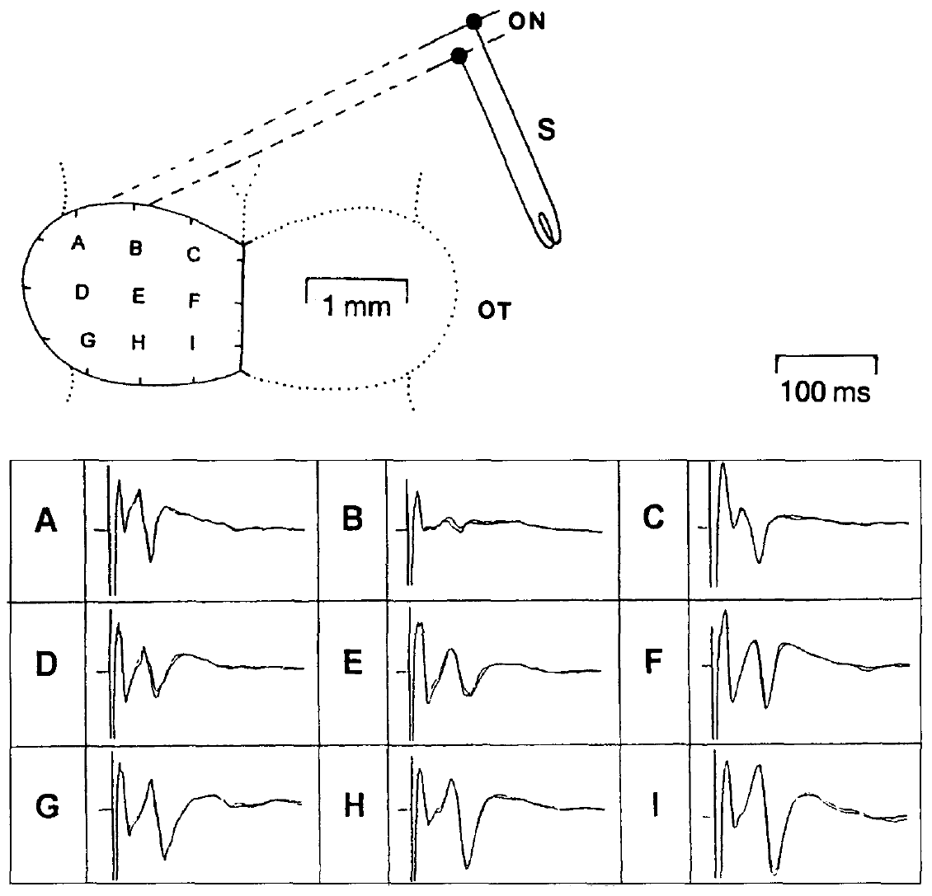
Electrical input separates timing from visual geometry
Schwippert and colleagues stimulated the contralateral optic nerve, the bundle carrying retinal axons to the brain, and recorded field potentials from nine sites over the dorsal tectal surface. The grid spans the tectal map with an original 1 mm anatomical calibration.
Short pulses of approximately 0.1 ms at currents up to 10 μA supplied a precisely timed input. Repeated optic-nerve stimulation at 0.8 Hz produced reproducible waveforms that could be compared with responses evoked by stimulating the pretectal Lpd/P region.
Bypassing the retinal image permits an analysis of input timing and interactions without changing object size or shape. A single pulse fires many optic axons at the same instant, producing a synchronized volley whose tectal effects can be timed to the millisecond.
Schwippert et al. (1995), Fig. 2. Optic-nerve stimulation and tectal recording grid with original 1 mm calibration.
Schwippert et al. (1995)
26
Notes:
Teaching transcript:
Schwippert and colleagues stimulated the contralateral **optic nerve**, the bundle carrying retinal axons to the brain, and recorded field potentials from nine sites over the dorsal tectal surface. The grid spans the tectal map with an original 1 mm anatomical calibration.
Short pulses of approximately 0.1 ms at currents up to 10 μA supplied a precisely timed input. Repeated optic-nerve stimulation at 0.8 Hz produced reproducible waveforms that could be compared with responses evoked by stimulating the pretectal Lpd/P region.
Bypassing the retinal image permits an analysis of input timing and interactions without changing object size or shape. Electrical activation does not reproduce a natural visual spike pattern, and a surface field potential reports population currents rather than one identified neuron’s membrane voltage.
A stimulus artifact is the electrical disturbance directly associated with the applied pulse. It must be distinguished from subsequent neural components. The nine-site grid allows the authors to compare where input effects are large, but it does not itself identify which cells generate the waveform.
References:
Schwippert WW, Beneke TW, Ewert JP (1995). Pretecto-tectal influences. II. How retinal and pretectal inputs to the toad’s superficial tectum interact: a study of electrically evoked field potentials. Journal of Comparative Physiology A 176(2):181–192. https://doi.org/10.1007/BF00239921
Schwippert et al. (1995), Fig. 2. Optic-nerve stimulation and tectal recording grid with original 1 mm calibration.
Figure source: https://doi.org/10.1007/BF00239921

Slide 37
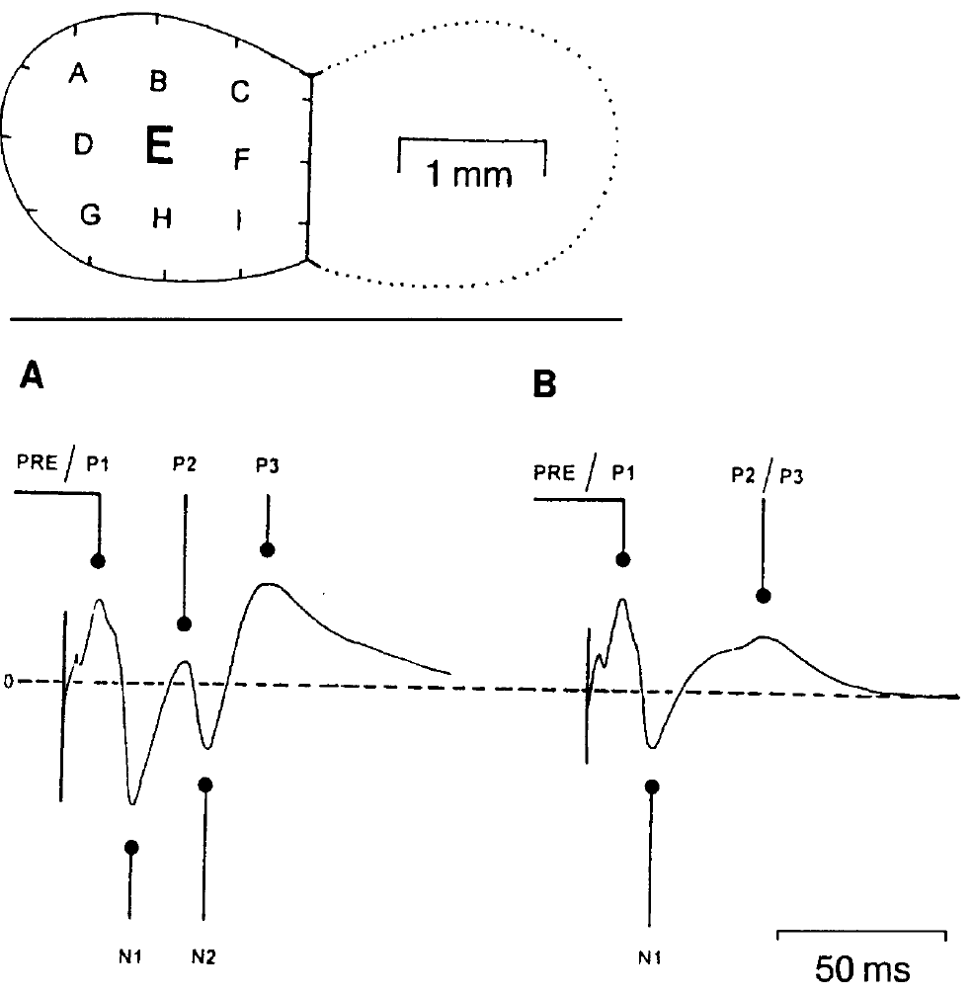
The optic-nerve response has separable components
The optic-nerve-evoked tectal field begins with a rapid presynaptic component, labeled PRE or P1 in the source recordings. Presynaptic denotes activity before transmission across a synapse; the later field waves reflect aggregate responses within the tectal layers.
Schwippert and colleagues distinguished the negative N1 wave and later positive and negative components. N1 began at approximately 11 ms and peaked around 18.7 ms; N2 began around 24 ms and peaked around 40.6 ms. Lower stimulus current could remove the later N2 component and merge positive components.
The timing permits selective comparison of an early retinotectal response with later activity. The interval between the presynaptic deflection and N1 onset includes synaptic delay, so N1 is the first wave generated by tectal cells receiving retinal input.
Schwippert et al. (1995), Fig. 3(A–B). Stimulus strength alters components of optic-nerve-evoked tectal field potentials.
Schwippert et al. (1995)
27
Notes:
Teaching transcript:
The optic-nerve-evoked tectal field begins with a rapid presynaptic component, labeled PRE or P1 in the source recordings. **Presynaptic** denotes activity before transmission across a synapse; the later field waves reflect aggregate responses within the tectal layers.
Schwippert and colleagues distinguished the negative N1 wave and later positive and negative components. N1 began at approximately 11 ms and peaked around 18.7 ms; N2 began around 24 ms and peaked around 40.6 ms. Lower stimulus current could remove the later N2 component and merge positive components.
The timing permits selective comparison of an early retinotectal response with later activity. These wave labels describe measured extracellular polarities and latencies; they are not names of receptor types, channels or single identified synaptic connections.
Negative and positive mean voltage relative to the recording reference. They do not mean that every cell is hyperpolarized or depolarized. The component separation is useful because conditioning can affect one part of the response while preserving others.
References:
Schwippert WW, Beneke TW, Ewert JP (1995). Pretecto-tectal influences. II. How retinal and pretectal inputs to the toad’s superficial tectum interact: a study of electrically evoked field potentials. Journal of Comparative Physiology A 176(2):181–192. https://doi.org/10.1007/BF00239921
Schwippert et al. (1995), Fig. 3(A–B). Stimulus strength alters components of optic-nerve-evoked tectal field potentials.
Figure source: https://doi.org/10.1007/BF00239921

Slide 38
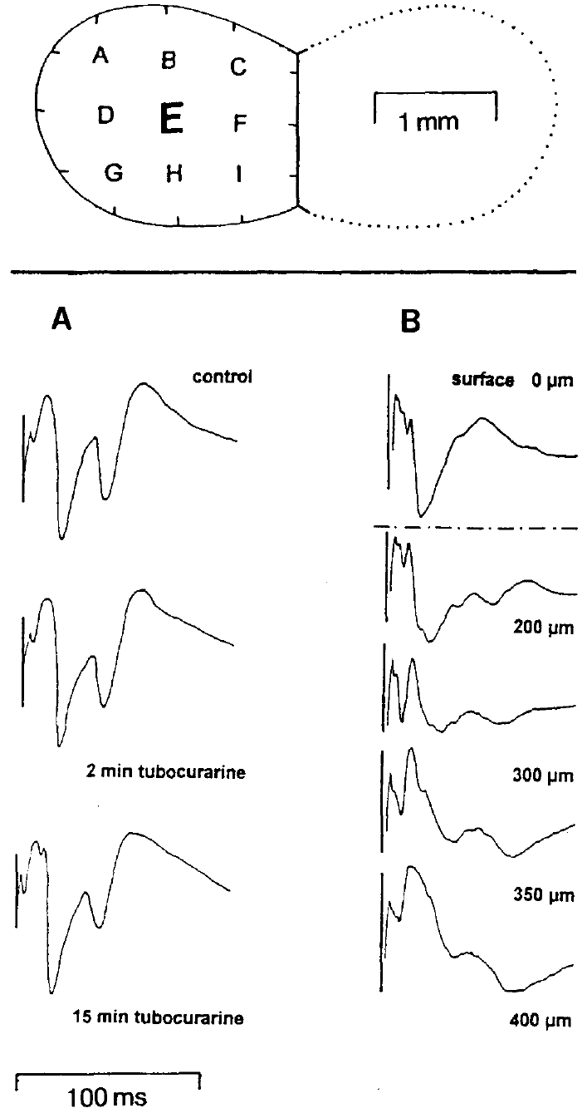
Field polarity depends on tectal recording depth
Schwippert and colleagues compared field responses recorded at the tectal surface and at successive depths. The optic tectum is laminated, meaning that neural elements and their connections are organized in layers with different orientations and positions.
The original records at approximately 200–400 μm below the surface differed in polarity from the surface waveform. Retinal axons terminate superficially, while tectal dendrites extend through the layered structure, so the electrode samples different arrangements of current sources and sinks.
A current sink is a region where extracellular current enters cells; a source is a region where it returns outward. Excitatory synapses on superficial dendrites form a sink near the surface while current returns through deeper parts of the same cells, so one synaptic event yields opposite polarities at different depths.
Schwippert et al. (1995), Fig. 1(A–B). Surface recordings after tubocurarine and recordings at successive tectal depths.
Schwippert et al. (1995)
28
Notes:
Teaching transcript:
Schwippert and colleagues compared field responses recorded at the tectal surface and at successive depths. The optic tectum is **laminated**, meaning that neural elements and their connections are organized in layers with different orientations and positions.
The original records at approximately 200–400 μm below the surface differed in polarity from the surface waveform. Retinal axons terminate superficially, while tectal dendrites extend through the layered structure, so the electrode samples different arrangements of current sources and sinks.
A **current sink** is a region where extracellular current enters cells; a source is a region where it returns outward. The depth dependence prevents equating a negative extracellular wave directly with membrane inhibition, excitation or a particular ionic conductance without additional physiological evidence.
The original depth series retains the reference position and scale. Changing the electrode depth changes the geometry of the currents that dominate the recording. The field’s sign is therefore an anatomical and electrical property of the population measurement, not a substitute for an intracellular voltage recording.
The same figure contains tubocurarine controls: optic-nerve responses remained qualitatively similar after immobilization. The control addresses the preparation, not the identity of a physiological inhibitory transmitter.
References:
Schwippert WW, Beneke TW, Ewert JP (1995). Pretecto-tectal influences. II. How retinal and pretectal inputs to the toad’s superficial tectum interact: a study of electrically evoked field potentials. Journal of Comparative Physiology A 176(2):181–192. https://doi.org/10.1007/BF00239921
Schwippert et al. (1995), Fig. 1(A–B). Surface recordings after tubocurarine and recordings at successive tectal depths.
Figure source: https://doi.org/10.1007/BF00239921

Slide 39
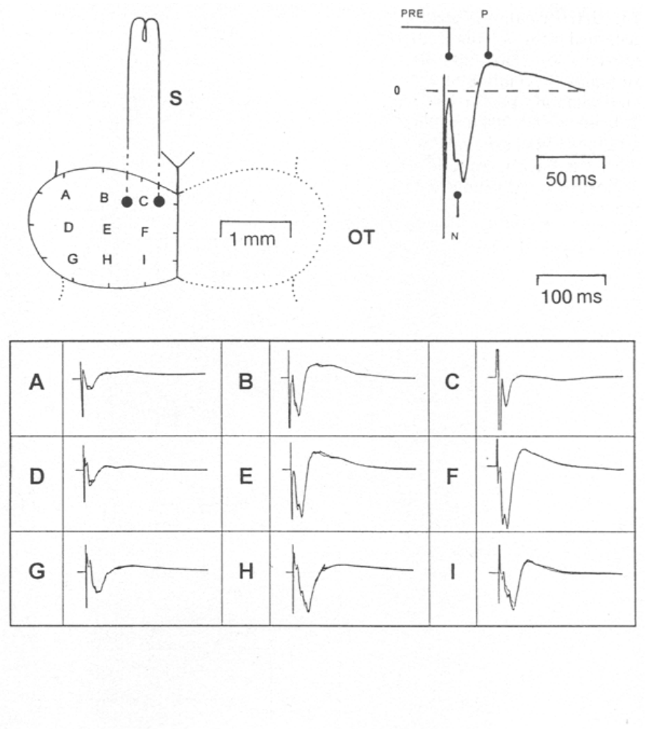
Ipsilateral pretectal stimulation has regional effects
The authors stimulated the Lpd/P region, comprising lateral posterodorsal and posterior pretectal areas, on the same side as the recorded tectum. The electrode approached beneath the rostral tectal lobe and stimulated at approximately 400–700 μm depth; histological marking verified the site.
Ipsilateral stimulation produced a negative wave beginning around 8–10 ms and peaking near 20 ms, followed by a positive component peaking around 40–45 ms. The negative response was largest at rostral dorsomedial recording sites, including sites E and F.
The spatial distribution supports an organized pretectal influence on the tectal map. Recording on the same nine-site grid used for optic-nerve responses allows pretectal and retinal effects to be compared at matching map positions, the arrangement needed to test how the inputs interact.
Schwippert et al. (1995), Fig. 4. Ipsilateral pretectal stimulation and regional tectal field responses.
Schwippert et al. (1995)
29
Notes:
Teaching transcript:
The authors stimulated the **Lpd/P region**, comprising lateral posterodorsal and posterior pretectal areas, on the same side as the recorded tectum. The electrode approached beneath the rostral tectal lobe and stimulated at approximately 400–700 μm depth; histological marking verified the site.
Ipsilateral stimulation produced a negative wave beginning around 8–10 ms and peaking near 20 ms, followed by a positive component peaking around 40–45 ms. The negative response was largest at rostral dorsomedial recording sites, including sites E and F.
The spatial distribution supports an organized pretectal influence on the tectal map. Activation of tissue near the marked site does not by itself distinguish a direct inhibitory projection from recruitment of an excitatory input that activates a tectal inhibitory relay.
The anatomical section identifies where the stimulation occurred, while the surface grid identifies where its effects were measured. The two positions are distinct. A negative population wave can accompany an inhibitory circuit effect because excitation of intermediary neurons may precede the final suppression.
References:
Schwippert WW, Beneke TW, Ewert JP (1995). Pretecto-tectal influences. II. How retinal and pretectal inputs to the toad’s superficial tectum interact: a study of electrically evoked field potentials. Journal of Comparative Physiology A 176(2):181–192. https://doi.org/10.1007/BF00239921
Schwippert et al. (1995), Fig. 4. Ipsilateral pretectal stimulation and regional tectal field responses.
Figure source: https://doi.org/10.1007/BF00239921

Slide 40
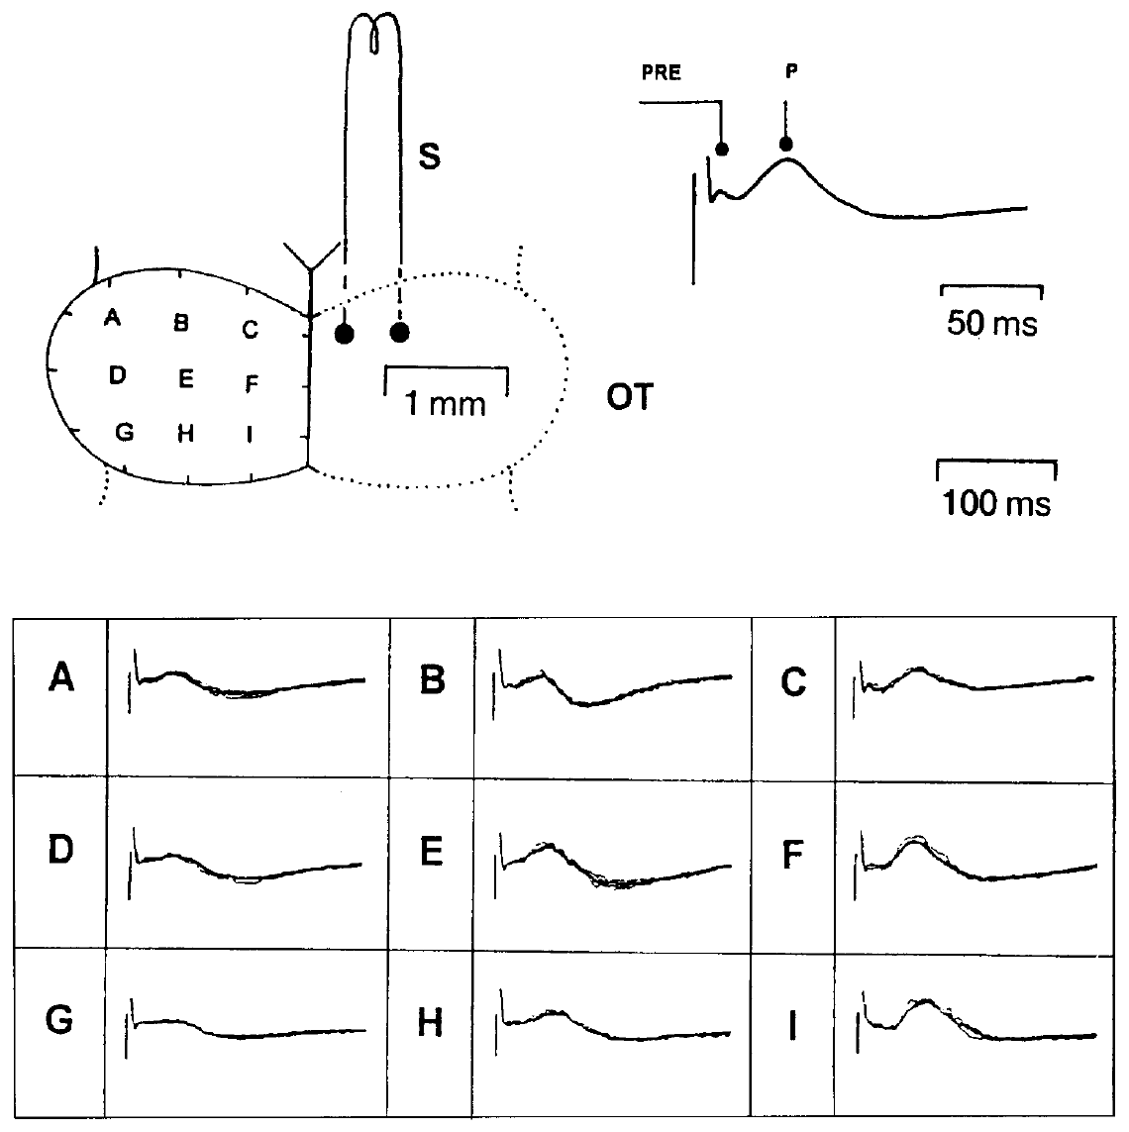
The opposite pretectum produces a different field
Schwippert and colleagues stimulated the pretectal Lpd/P region contralateral to the recorded tectum and compared the resulting waveform with ipsilateral stimulation. The same tectal grid allowed side-dependent input effects to be measured across corresponding locations.
Contralateral stimulation produced a small early component around 5–7 ms and a predominantly positive wave beginning around 14–16 ms and peaking approximately 35–45 ms. The conspicuous negative wave produced by ipsilateral pretectal stimulation was not a comparable feature of this response.
The side-dependent difference is consistent with different routes or local circuit recruitment by the two inputs. Each pretectum therefore acts on the two tecta in different ways, so pretectal activity on one side shapes tectal responses on both sides of the brain.
Schwippert et al. (1995), Fig. 5. Contralateral pretectal stimulation evokes a predominantly positive tectal wave.
Schwippert et al. (1995)
30
Notes:
Teaching transcript:
Schwippert and colleagues stimulated the pretectal Lpd/P region contralateral to the recorded tectum and compared the resulting waveform with ipsilateral stimulation. The same tectal grid allowed side-dependent input effects to be measured across corresponding locations.
Contralateral stimulation produced a small early component around 5–7 ms and a predominantly positive wave beginning around 14–16 ms and peaking approximately 35–45 ms. The conspicuous negative wave produced by ipsilateral pretectal stimulation was not a comparable feature of this response.
The side-dependent difference is consistent with different routes or local circuit recruitment by the two inputs. Extracellular polarity alone cannot establish a particular inhibitory receptor, prove that no excitatory cells are involved, or identify a single commissural connection as the entire pathway.
The two stimulation conditions differ in anatomical side while the recording is made from the same tectal surface. Comparing them tests lateral organization. Similar broad anatomical regions can influence the tectum through physiologically different sequences of activity.
References:
Schwippert WW, Beneke TW, Ewert JP (1995). Pretecto-tectal influences. II. How retinal and pretectal inputs to the toad’s superficial tectum interact: a study of electrically evoked field potentials. Journal of Comparative Physiology A 176(2):181–192. https://doi.org/10.1007/BF00239921
Schwippert et al. (1995), Fig. 5. Contralateral pretectal stimulation evokes a predominantly positive tectal wave.
Figure source: https://doi.org/10.1007/BF00239921

Slide 41
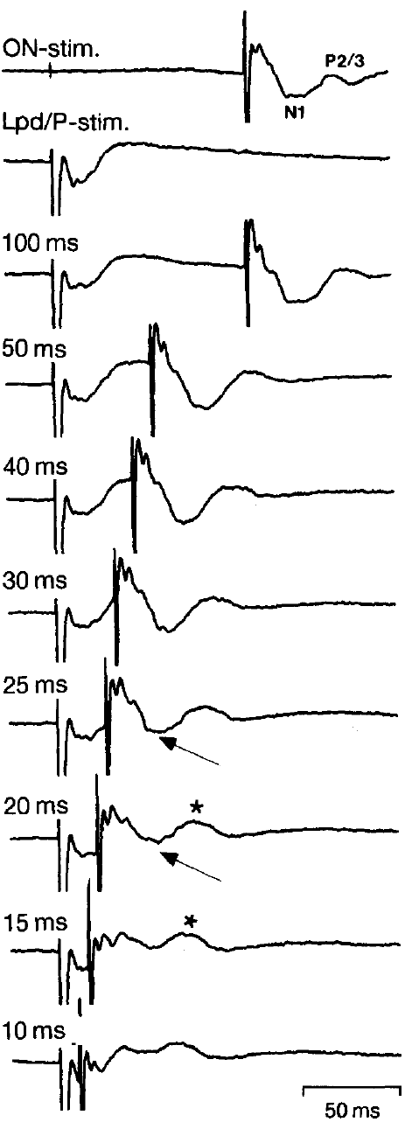
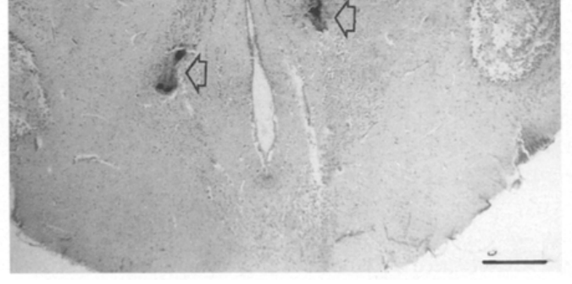
A pretectal lead suppresses the early retinal wave
The paired-stimulation experiment delivered a pretectal Lpd/P pulse before an optic-nerve pulse. Conditioning is the earlier input whose effect on the later test response is measured; the interval between pulses controls when the pathways can interact.
When the pretectal input preceded the optic-nerve input by approximately 17–25 ms, the early negative N1 component was strongly attenuated or nearly absent. At longer intervals of about 30–100 ms, the same strong reduction was not evident. Some later components remained comparatively preserved.
The narrow effective interval supports a timed neural interaction rather than a permanent loss of retinal input. Pretectal activity suppresses retinal input to the tectum most strongly during a brief period after it begins, an inhibitory window measured in tens of milliseconds.
Schwippert et al. (1995), Fig. 4 (histology). Marked Lpd site (250 μm).
Schwippert et al. (1995), Fig. 6. Paired pretectal and optic-nerve stimuli separated by 10–100 ms.
Schwippert et al. (1995)
31
Notes:
Teaching transcript:
The paired-stimulation experiment delivered a pretectal Lpd/P pulse before an optic-nerve pulse. **Conditioning** is the earlier input whose effect on the later test response is measured; the interval between pulses controls when the pathways can interact.
When the pretectal input preceded the optic-nerve input by approximately 17–25 ms, the early negative N1 component was strongly attenuated or nearly absent. At longer intervals of about 30–100 ms, the same strong reduction was not evident. Some later components remained comparatively preserved.
The narrow effective interval supports a timed neural interaction rather than a permanent loss of retinal input. It does not mean that visual avoidance starts exactly 20 ms after a predator appears or that a single inhibitory synapse accounts for the population effect.
The delay is imposed between two electrical pulses, not measured from the appearance of a natural object. The response remains after sufficiently long delays, making the time-dependent suppression different from cutting the optic nerve or permanently silencing the tectum.
References:
Schwippert WW, Beneke TW, Ewert JP (1995). Pretecto-tectal influences. II. How retinal and pretectal inputs to the toad’s superficial tectum interact: a study of electrically evoked field potentials. Journal of Comparative Physiology A 176(2):181–192. https://doi.org/10.1007/BF00239921
Schwippert et al. (1995), Fig. 6. Paired pretectal and optic-nerve stimuli separated by 10–100 ms.
Figure source: https://doi.org/10.1007/BF00239921
Schwippert et al. (1995), Fig. 4 (histology). Marked Lpd site (250 μm).
Figure source: https://doi.org/10.1007/BF00239921

Slide 42
The suppression window matches the pretectal wave
Ipsilateral pretectal stimulation alone evokes a negative tectal wave peaking near 20 ms and a positive wave peaking around 40–45 ms. Schwippert and Ewert interpreted negative tectal waves as resembling excitatory postsynaptic processes and later positive waves as resembling inhibitory ones.
The two delays combine to explain the effective lead. With the pretectal pulse about 20 ms ahead, the retinal N1, which peaks near 18.7 ms after its own pulse, arrives roughly when the pretectal positive wave peaks. Retinal excitation then reaches tectal tissue at the height of the inhibitory-like phase.
At leads of 30–100 ms the retinal wave arrives after that phase has passed, and suppression fades. A large moving object that drives pretectal cells repeatedly would renew the window, holding retinal input down while the object moves.
Schwippert et al. (1995), Fig. 4 (histology). Marked Lpd site (250 μm).
Schwippert et al. (1995), Fig. 6. Paired pretectal and optic-nerve stimuli separated by 10–100 ms.
Schwippert et al. (1995); Schwippert & Ewert (1995)
31a
Notes:
The narrow 17 to 25 millisecond window on slide 31 can be predicted from latencies measured on two other slides.
The pretectal response on its own.
Slide 29 gives the time course of the tectal response to an ipsilateral pretectal pulse: an early negative wave and a later positive wave peaking around 40 to 45 milliseconds.
In the neuropeptide paper, Schwippert and Ewert describe the negative wave as resembling excitatory postsynaptic activity and the positive wave as resembling inhibitory postsynaptic activity.
Lining up two latencies.
Slide 27 places the N1 peak at about 18.7 milliseconds after an optic-nerve pulse.
If the pretectal pulse comes about 20 milliseconds first, N1 lands near the peak of the pretectal positive wave, which is when the test response should be most reduced.
Outside the window.
With a much longer lead, the pretectal positive phase is over by the time retinal input arrives, matching the weak effect at 30 to 100 milliseconds.
On slide 33 a large moving object can suppress the optic-nerve response and that the effect can last beyond the stimulus, as repeated pretectal activation would predict.
References:
Schwippert WW, Beneke TW, Ewert JP (1995). Pretecto-tectal influences. II. How retinal and pretectal inputs to the toad’s superficial tectum interact: a study of electrically evoked field potentials. Journal of Comparative Physiology A 176(2):181–192. https://doi.org/10.1007/BF00239921
Schwippert WW, Ewert JP (1995). Effect of neuropeptide-Y on tectal field potentials in the toad. Brain Research 669(1):150–152. https://doi.org/10.1016/0006-8993(94)01260-O

Slide 43
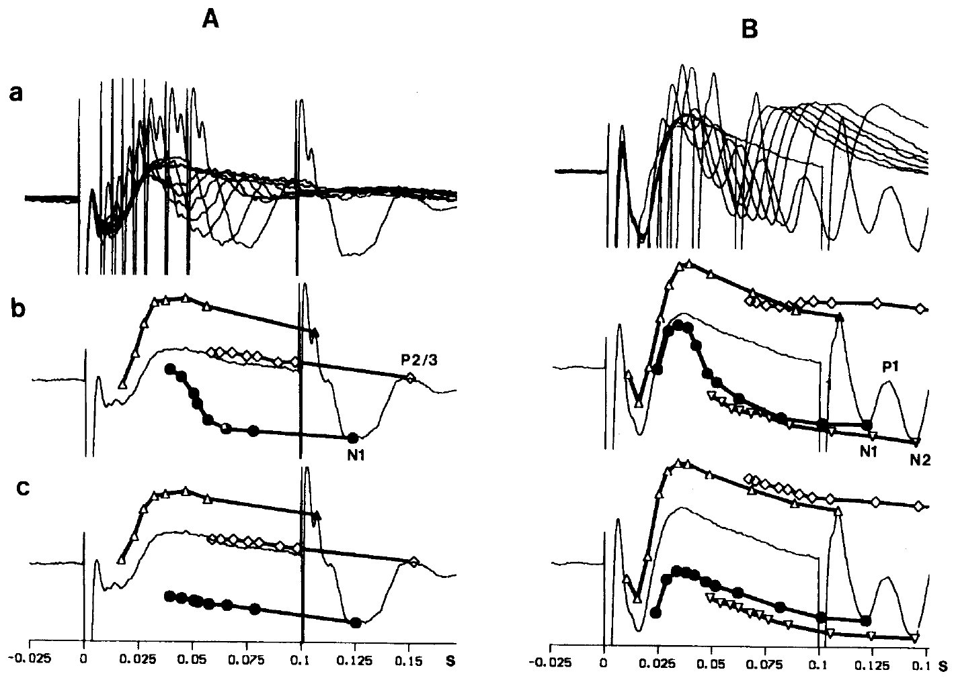
Stimulus strength changes which waves are suppressed
Schwippert and colleagues varied optic-nerve stimulus strength while changing the delay after pretectal stimulation. Weak and stronger test inputs recruited different combinations of early and later components, permitting the effect to be evaluated beyond a single waveform amplitude.
At effective delays near 20–25 ms, the early negative component was attenuated. With stronger optic-nerve stimulation, effects on the later negative component were also evident, while positive components could remain relatively unaffected. The original delay plots retain the timings and component-specific measurements.
Schwippert et al. (1995), Fig. 7(A–B). Delay effects at two input strengths; rows c are the authors’ theoretical summation comparison.
The interaction therefore depends on both the timing and the recruited input population. Selective attenuation supports circuit regulation rather than uniform elimination of all tectal activity: a strong retinal input recruits later components that become further targets of pretectal suppression.
Schwippert et al. (1995), Fig. 4 (histology). Marked Lpd site (250 μm).
Schwippert et al. (1995)
32
Notes:
Teaching transcript:
Schwippert and colleagues varied optic-nerve stimulus strength while changing the delay after pretectal stimulation. Weak and stronger test inputs recruited different combinations of early and later components, permitting the effect to be evaluated beyond a single waveform amplitude.
At effective delays near 20–25 ms, the early negative component was attenuated. With stronger optic-nerve stimulation, effects on the later negative component were also evident, while positive components could remain relatively unaffected. The original delay plots retain the timings and component-specific measurements.
The interaction therefore depends on both the timing and the recruited input population. Selective attenuation supports circuit regulation rather than uniform elimination of all tectal activity, but the recordings cannot assign each component to one chemically identified neuron class.
A stronger nerve stimulus can recruit additional axons and response components. Its effect is not equivalent to simply making a natural prey object larger. The component-dependent changes constrain possible mechanisms without providing a receptor-level explanation.
Rows c in the original figure are the authors’ theoretical summation comparison, whereas rows a and b contain experimental response comparisons. The theoretical rows are not additional measured biological responses.
References:
Schwippert WW, Beneke TW, Ewert JP (1995). Pretecto-tectal influences. II. How retinal and pretectal inputs to the toad’s superficial tectum interact: a study of electrically evoked field potentials. Journal of Comparative Physiology A 176(2):181–192. https://doi.org/10.1007/BF00239921
Schwippert et al. (1995), Fig. 7(A–B). Delay effects at two input strengths; rows c are the authors’ theoretical summation comparison.
Figure source: https://doi.org/10.1007/BF00239921
Schwippert et al. (1995), Fig. 4 (histology). Marked Lpd site (250 μm).
Figure source: https://doi.org/10.1007/BF00239921

Slide 44
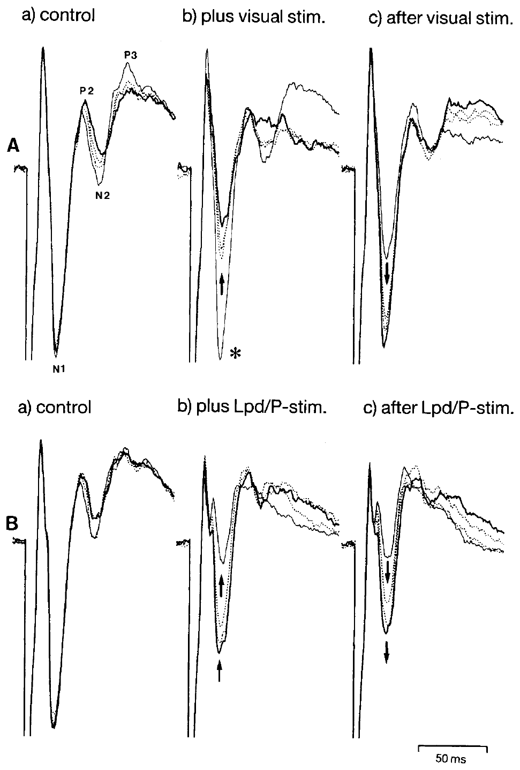
A visual conditioner can reduce the retinal response
The authors established a steady tectal field response with optic-nerve stimulation at 0.8 Hz, then moved a large black object across the corresponding visual input between electrical test pulses. The retinal image was therefore present as a conditioner rather than as the electrically timed test signal.
The subsequent negative N1 and N2 components were reduced, and suppression could persist after the visual stimulation. A brief train of pretectal pulses at 10 Hz for approximately 1 second produced a comparable attenuation of negative components.
The visual effect links the electrical interaction to a natural route of sensory activation. Large moving objects, the stimuli that release avoidance, thereby reduce the tectal signal on which prey-catching depends, as pretectal stimulation does.
Schwippert et al. (1995), Fig. 8(A–B). Visual and pretectal conditioning attenuate optic-nerve-evoked tectal responses.
Schwippert et al. (1995), Fig. 4 (histology). Marked Lpd site (250 μm).
Schwippert et al. (1995)
33
Notes:
Teaching transcript:
The authors established a steady tectal field response with optic-nerve stimulation at 0.8 Hz, then moved a large black object across the corresponding visual input between electrical test pulses. The retinal image was therefore present as a conditioner rather than as the electrically timed test signal.
The subsequent negative N1 and N2 components were reduced, and suppression could persist after the visual stimulation. A brief train of pretectal pulses at 10 Hz for approximately 1 second produced a comparable attenuation of negative components.
The visual effect links the electrical interaction to a natural route of sensory activation. A large moving object can recruit several retinal and central pathways, so similar field suppression does not prove that visual and electrical conditioning use exactly the same cells.
The comparison preserves the optic-nerve test pulse and changes the intervening conditioner. It is evidence that sensory stimulation can influence the same measured response components, rather than evidence that the visual object generates the same spike pattern as the pretectal electrode.
References:
Schwippert WW, Beneke TW, Ewert JP (1995). Pretecto-tectal influences. II. How retinal and pretectal inputs to the toad’s superficial tectum interact: a study of electrically evoked field potentials. Journal of Comparative Physiology A 176(2):181–192. https://doi.org/10.1007/BF00239921
Schwippert et al. (1995), Fig. 8(A–B). Visual and pretectal conditioning attenuate optic-nerve-evoked tectal responses.
Figure source: https://doi.org/10.1007/BF00239921
Schwippert et al. (1995), Fig. 4 (histology). Marked Lpd site (250 μm).
Figure source: https://doi.org/10.1007/BF00239921

Slide 45
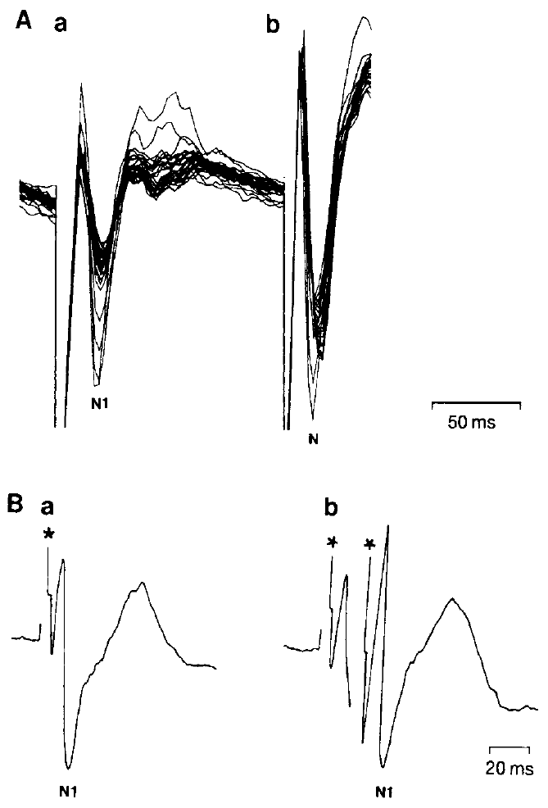
Repetition controls challenge a simple adaptation account
Adaptation is a change in responsiveness caused by preceding activity. An alternative explanation for paired-input suppression was that the first pulse simply exhausted the same excitable pathway later recruited by the optic-nerve test pulse.
Schwippert and colleagues alternated optic-nerve and pretectal stimulation at 4 Hz, equivalent to a 125 ms separation. Their responses changed differently with repetition. Two optic-nerve pulses separated by 20 ms did not produce the same obvious attenuation of N1 in the second field response as the effective pretectal conditioning pulse.
Schwippert et al. (1995), Fig. 9(A–B). Repetition and paired optic-nerve controls test an adaptation explanation.
The controls weaken a simple shared-pathway adaptation explanation and the possibility that pretectal current merely spreads to the adjacent optic tract. Suppression of N1 therefore depends on activity arriving from the pretectum, not on prior use of the retinotectal pathway.
Schwippert et al. (1995), Fig. 4 (histology). Marked Lpd site (250 μm).
Schwippert et al. (1995)
34
Notes:
Teaching transcript:
**Adaptation** is a change in responsiveness caused by preceding activity. An alternative explanation for paired-input suppression was that the first pulse simply exhausted the same excitable pathway later recruited by the optic-nerve test pulse.
Schwippert and colleagues alternated optic-nerve and pretectal stimulation at 4 Hz, equivalent to a 125 ms separation. Their responses changed differently with repetition. Two optic-nerve pulses separated by 20 ms did not produce the same obvious attenuation of N1 in the second field response as the effective pretectal conditioning pulse.
The controls weaken a simple shared-pathway adaptation explanation and the possibility that pretectal current merely spreads to the adjacent optic tract. They support a pathway-specific interaction without excluding every possible form of network adaptation.
An adaptation hypothesis predicts consequences of repeating the test input itself. The paired optic-nerve control tests that prediction at the effective short interval. A failed simple adaptation account does not establish the identity of the inhibitory relay or the final receptor mechanism.
References:
Schwippert WW, Beneke TW, Ewert JP (1995). Pretecto-tectal influences. II. How retinal and pretectal inputs to the toad’s superficial tectum interact: a study of electrically evoked field potentials. Journal of Comparative Physiology A 176(2):181–192. https://doi.org/10.1007/BF00239921
Schwippert et al. (1995), Fig. 9(A–B). Repetition and paired optic-nerve controls test an adaptation explanation.
Figure source: https://doi.org/10.1007/BF00239921
Schwippert et al. (1995), Fig. 4 (histology). Marked Lpd site (250 μm).
Figure source: https://doi.org/10.1007/BF00239921

Slide 46
Inhibitory network effects need not be a direct synapse
Pretectal stimulation reduced a later retinally evoked tectal field component, but ipsilateral pretectal stimulation alone also produced a negative wave. Schwippert and colleagues considered multiple circuit arrangements compatible with this combination of recorded effects.
An excitatory pretectal input could recruit an inhibitory tectal interneuron, a neuron connecting cells within a local circuit. Alternatively, regulation could occur at retinal terminals through presynaptic inhibition, a reduction of transmission before the postsynaptic target receives its input. The paired effect is strongest at approximately 17–25 ms.
The population recordings support an inhibitory influence at the network level. Anatomy fits a presynaptic route for one candidate signal: NPY-containing pretectal projections reach the superficial tectum near retinal terminals.
Schwippert et al. (1995), Fig. 4. Ipsilateral pretectal stimulation and regional tectal field responses.
Schwippert et al. (1995)
35
Notes:
Teaching transcript:
Pretectal stimulation reduced a later retinally evoked tectal field component, but ipsilateral pretectal stimulation alone also produced a negative wave. Schwippert and colleagues considered multiple circuit arrangements compatible with this combination of recorded effects.
An excitatory pretectal input could recruit an inhibitory tectal interneuron, a neuron connecting cells within a local circuit. Alternatively, regulation could occur at retinal terminals through **presynaptic inhibition**, a reduction of transmission before the postsynaptic target receives its input. The paired effect is strongest at approximately 17–25 ms.
The population recordings support an inhibitory influence at the network level. They do not distinguish every synaptic step, establish which interneuron releases a transmitter, or directly measure an identified receptor-mediated inhibitory current.
A pathway can have an excitatory first synapse and an inhibitory net effect. Direct pretectal inhibition, recruitment of local inhibition and regulation of retinal transmitter release are different mechanistic claims. The waveform alone is insufficient to choose conclusively among them.
References:
Schwippert WW, Beneke TW, Ewert JP (1995). Pretecto-tectal influences. II. How retinal and pretectal inputs to the toad’s superficial tectum interact: a study of electrically evoked field potentials. Journal of Comparative Physiology A 176(2):181–192. https://doi.org/10.1007/BF00239921
Schwippert et al. (1995), Fig. 4. Ipsilateral pretectal stimulation and regional tectal field responses.
Figure source: https://doi.org/10.1007/BF00239921

Slide 47
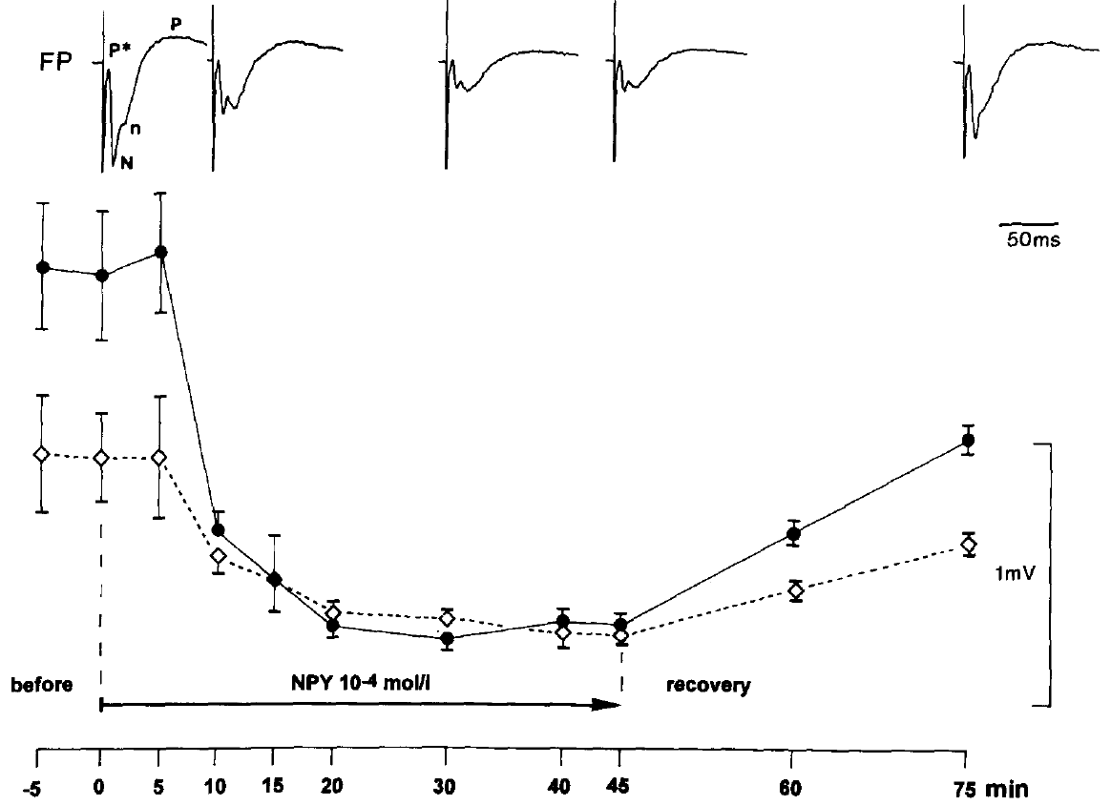
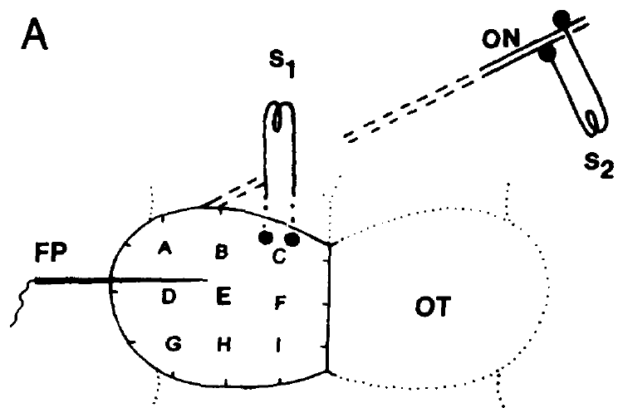
NPY application reduces an evoked tectal response
Neuropeptide Y, or NPY, is a peptide signaling molecule investigated as a possible contributor to pretectal regulation. Schwippert and Ewert applied synthetic NPY locally to the superficial tectum of cane toads while measuring the field evoked by optic-nerve pulses at 0.8 Hz.
A solution at 10⁻⁴ mol/L, equivalent to 100 μM, was delivered by a micropipette near the recording site. Within approximately 5–10 minutes, the negative field component fell to about 24% of its initial amplitude. The initial and later positive components were affected much less.
Schwippert & Ewert (1995), Fig. 2. NPY application reduces the negative tectal wave and partial recovery follows removal.
Local NPY is therefore sufficient to attenuate a measured retinotectal population response under these conditions. The peptide reduced the same negative component that pretectal electrical conditioning suppresses, linking a pretectal transmitter candidate to the timed interaction.
Schwippert & Ewert (1995), Fig. 1(A). Stimulation and recording sites.
Schwippert & Ewert (1995)
36
Notes:
Teaching transcript:
**Neuropeptide Y**, or NPY, is a peptide signaling molecule investigated as a possible contributor to pretectal regulation. Schwippert and Ewert applied synthetic NPY locally to the superficial tectum of cane toads while measuring the field evoked by optic-nerve pulses at 0.8 Hz.
A solution at 10⁻⁴ mol/L, equivalent to 100 μM, was delivered by a micropipette near the recording site. Within approximately 5–10 minutes, the negative field component fell to about 24% of its initial amplitude. The initial and later positive components were affected much less.
Local NPY is therefore sufficient to attenuate a measured retinotectal population response under these conditions. Its effect does not establish that endogenous NPY is necessary for prey rejection or that a physiological release event reaches the applied concentration.
A peptide application is a pharmacological intervention, not a recording of natural peptide release. The spatially local delivery and component-specific effect connect NPY to tectal input regulation, while the relatively high applied concentration limits direct inference about its normal extracellular level.
References:
Schwippert WW, Ewert JP (1995). Effect of neuropeptide-Y on tectal field potentials in the toad. Brain Research 669(1):150–152. https://doi.org/10.1016/0006-8993(94)01260-O
Schwippert & Ewert (1995), Fig. 2. NPY application reduces the negative tectal wave and partial recovery follows removal.
Figure source: https://doi.org/10.1016/0006-8993(94)01260-O
Schwippert & Ewert (1995), Fig. 1(A). Stimulation and recording sites.
Figure source: https://doi.org/10.1016/0006-8993(94)01260-O

Slide 48
Vehicle and recovery constrain the peptide result
Schwippert and Ewert compared NPY delivery with delivery of Frog-Ringer solution alone. The vehicle is the solution carrying a drug or peptide; a vehicle control tests whether fluid application or the carrier produces the measured effect independently of the active substance.
Ringer solution did not produce the same strong attenuation of the negative wave. After removal of the NPY pipette, the response recovered to approximately 65% of its original amplitude over about 30 minutes. Recovery was substantial but incomplete over the reported interval.
Schwippert & Ewert (1995), Fig. 2. NPY application reduces the negative tectal wave and partial recovery follows removal.
The comparisons support a reversible peptide-dependent effect rather than irreversible destruction of the retinal input. The Ringer comparison places the cause in the NPY molecule rather than in pressure, flow or dilution from the pipette.
Schwippert & Ewert (1995), Fig. 1(A). Stimulation and recording sites.
Schwippert & Ewert (1995)
37
Notes:
Teaching transcript:
Schwippert and Ewert compared NPY delivery with delivery of Frog-Ringer solution alone. The **vehicle** is the solution carrying a drug or peptide; a vehicle control tests whether fluid application or the carrier produces the measured effect independently of the active substance.
Ringer solution did not produce the same strong attenuation of the negative wave. After removal of the NPY pipette, the response recovered to approximately 65% of its original amplitude over about 30 minutes. Recovery was substantial but incomplete over the reported interval.
The comparisons support a reversible peptide-dependent effect rather than irreversible destruction of the retinal input. They do not identify a receptor subtype, measure peptide clearance directly, or establish that the partial recovery corresponds to a normal behavioral recovery process.
The vehicle condition separates application of liquid from application of NPY. The recovery measurement supports reversibility, but a return to 65% is not a complete return to baseline. No claim that the toad’s prey-catching behavior recovered accompanies this field-potential experiment.
References:
Schwippert WW, Ewert JP (1995). Effect of neuropeptide-Y on tectal field potentials in the toad. Brain Research 669(1):150–152. https://doi.org/10.1016/0006-8993(94)01260-O
Schwippert & Ewert (1995), Fig. 2. NPY application reduces the negative tectal wave and partial recovery follows removal.
Figure source: https://doi.org/10.1016/0006-8993(94)01260-O
Schwippert & Ewert (1995), Fig. 1(A). Stimulation and recording sites.
Figure source: https://doi.org/10.1016/0006-8993(94)01260-O

Slide 49
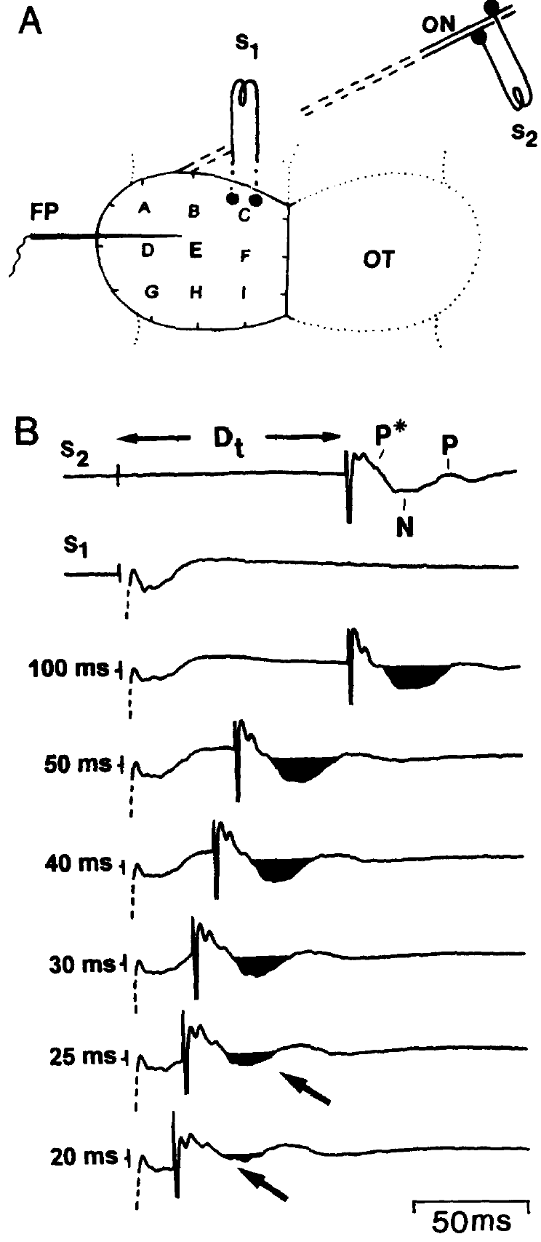
The peptide effect is slower than electrical conditioning
Electrical pretectal conditioning attenuated the negative retinally evoked field at a pulse separation around 20–25 ms, whereas locally applied NPY required approximately 5–10 minutes for strong attenuation. The two interventions probe related response components on very different experimental timescales.
The NPY pipette was positioned approximately 200–300 μm from the recording site, so diffusion and delivery through tissue contribute to the application delay. That delay is not a measurement of how fast a pretectal neuron releases endogenous peptide during a visual encounter.
Similarity of the affected component supports a possible relation between peptide modulation and pretectal regulation. Both interventions reduced the negative wave while leaving positive components less affected, so they act on the same stage of retinotectal transmission.
Schwippert & Ewert (1995), Fig. 1(A–B). Pretectal stimulation arrangement and delay-dependent suppression of the negative wave.
Schwippert & Ewert (1995); Schwippert et al. (1995)
38
Notes:
Teaching transcript:
Electrical pretectal conditioning attenuated the negative retinally evoked field at a pulse separation around 20–25 ms, whereas locally applied NPY required approximately 5–10 minutes for strong attenuation. The two interventions probe related response components on very different experimental timescales.
The NPY pipette was positioned approximately 200–300 μm from the recording site, so diffusion and delivery through tissue contribute to the application delay. That delay is not a measurement of how fast a pretectal neuron releases endogenous peptide during a visual encounter.
Similarity of the affected component supports a possible relation between peptide modulation and pretectal regulation. Different delivery conditions prevent equating the pharmacological time course with the latency of a naturally occurring synaptic inhibitory event.
A bath or pipette application introduces transport through tissue before receptors are reached. A pulse delivered inside a pathway has a different starting point. Comparing their outcomes is informative, but assigning the millisecond conditioning effect to the minute-scale application curve would exceed the experiment.
References:
Schwippert WW, Ewert JP (1995). Effect of neuropeptide-Y on tectal field potentials in the toad. Brain Research 669(1):150–152. https://doi.org/10.1016/0006-8993(94)01260-O
Schwippert WW, Beneke TW, Ewert JP (1995). Pretecto-tectal influences. II. How retinal and pretectal inputs to the toad’s superficial tectum interact: a study of electrically evoked field potentials. Journal of Comparative Physiology A 176(2):181–192. https://doi.org/10.1007/BF00239921
Schwippert & Ewert (1995), Fig. 1(A–B). Pretectal stimulation arrangement and delay-dependent suppression of the negative wave.
Figure source: https://doi.org/10.1016/0006-8993(94)01260-O

Slide 50
Peptides add slow suppression to fast inhibition
Neuropeptides are stored in dense-core vesicles and are typically released when a neuron fires repeatedly or at high frequency, unlike small-molecule transmitters released by single spikes. Most act through G-protein-coupled receptors, changing excitability over seconds to minutes.
Pretectal stimulation at 10 Hz for about 1 second attenuated the negative tectal components as a large visual object did, and the suppression could persist afterward. Repetitive activation of that kind favors release from NPY-containing pretectal terminals, and minute-scale NPY action fits suppression that outlasts its trigger.
The two mechanisms would divide the work. A fast inhibitory link limits each retinal volley within tens of milliseconds, while peptide signaling, recruited only by sustained pretectal activity, keeps tectal input reduced for minutes.
Schwippert & Ewert (1995), Fig. 1(A–B). Pretectal stimulation arrangement and delay-dependent suppression of the negative wave.
Schwippert & Ewert (1995); Schwippert et al. (1995)
38a
Notes:
Slide 38 contrasts a millisecond electrical effect with a minute-scale peptide effect; the biology of peptide release explains how both could belong to one pretectal output.
How peptides are released and act.
Dense-core vesicles sit away from the active zone, so a single spike rarely releases them, while trains of spikes raise calcium enough to do so.
Receptors coupled to G proteins act through intracellular signaling, which is slower to start and slower to stop than ion-channel receptors.
Matching the tectal results.
On slide 33 a brief 10 hertz pretectal train and a large moving object both reduced the negative components, and the suppression could continue after the conditioning ended.
Slide 39 notes NPY-containing pretectal projections near retinal terminals, and slide 36 shows the peptide reduces the same negative wave.
Two timescales from one region.
The paired-pulse window on slide 31 matches a fast synaptic step, while the peptide's minutes-long action matches lasting suppression.
This division is a proposal built from the deck's results; the peptide's release during visual stimulation was not measured.
References:
Schwippert WW, Ewert JP (1995). Effect of neuropeptide-Y on tectal field potentials in the toad. Brain Research 669(1):150–152. https://doi.org/10.1016/0006-8993(94)01260-O
Schwippert WW, Beneke TW, Ewert JP (1995). Pretecto-tectal influences. II. How retinal and pretectal inputs to the toad’s superficial tectum interact: a study of electrically evoked field potentials. Journal of Comparative Physiology A 176(2):181–192. https://doi.org/10.1007/BF00239921

Slide 51
NPY does not identify the complete inhibitory pathway
Schwippert and Ewert related their NPY effect to published anatomical evidence for NPY-containing pretectal projections and superficial tectal fibers near retinal terminals. This distribution is compatible with a peptide influence on incoming visual transmission.
They proposed that NPY might reduce excitation at retinal terminals, a form of presynaptic inhibition. The measured result remains a reduction of the negative field to approximately 24% after local peptide application; no individual retinal terminal or postsynaptic cell was recorded intracellularly in this test.
Schwippert & Ewert (1995), Fig. 2. NPY application reduces the negative tectal wave and partial recovery follows removal.
Presynaptic inhibition at retinal terminals would reduce transmitter release from optic axons, shrinking the negative wave generated by tectal cells while leaving the incoming axonal volley intact. The initial component, which NPY affected much less, fits that account.
Schwippert & Ewert (1995), Fig. 1(A). Stimulation and recording sites.
Schwippert & Ewert (1995)
39
Notes:
Teaching transcript:
Schwippert and Ewert related their NPY effect to published anatomical evidence for NPY-containing pretectal projections and superficial tectal fibers near retinal terminals. This distribution is compatible with a peptide influence on incoming visual transmission.
They proposed that NPY might reduce excitation at retinal terminals, a form of presynaptic inhibition. The measured result remains a reduction of the negative field to approximately 24% after local peptide application; no individual retinal terminal or postsynaptic cell was recorded intracellularly in this test.
The study did not establish a particular NPY receptor subtype, demonstrate endogenous peptide release during avoidance, or block an identified ion channel to test its necessity. A candidate transmitter and a demonstrated complete synaptic mechanism are different levels of explanation.
Receptor and channel specificity would require interventions that distinguish those molecular steps. Anatomical proximity and a similar population-field effect make a proposed mechanism plausible, but neither substitutes for measuring the relevant synaptic current or selectively preventing natural signaling.
References:
Schwippert WW, Ewert JP (1995). Effect of neuropeptide-Y on tectal field potentials in the toad. Brain Research 669(1):150–152. https://doi.org/10.1016/0006-8993(94)01260-O
Schwippert & Ewert (1995), Fig. 2. NPY application reduces the negative tectal wave and partial recovery follows removal.
Figure source: https://doi.org/10.1016/0006-8993(94)01260-O
Schwippert & Ewert (1995), Fig. 1(A). Stimulation and recording sites.
Figure source: https://doi.org/10.1016/0006-8993(94)01260-O

Slide 52
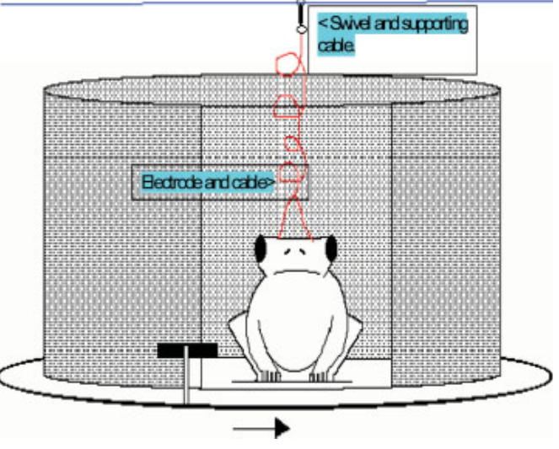
DC stimulation tests avoidance in behaving toads
McConville and Laming applied direct current, or DC, a sustained electrical current, over the pretectal region while adult common toads viewed a moving prey-like object. The positive electrode contacted the right surface over the lateral posterodorsal nucleus, or Lpd.
A black cardboard object 3 cm long and 0.75 cm wide moved at approximately 2 cm/s around a viewing window. Both clockwise and anticlockwise movement were tested, providing opposite directions of visual motion while retaining the same physical object and chamber.
McConville & Laming (2007), Fig. 1. Original colored behavioral chamber for visual and electrical stimulation.
The experiment tested whether stimulation could bias an intact behaving animal away from prey approach and toward defensive actions. Lesions had removed pretectal restraint; added current tests the converse prediction, that raising pretectal activity should strengthen restraint of feeding.
McConville & Laming (2007), Fig. 3. Lpd electrodes.
McConville & Laming (2007)
40
Notes:
Teaching transcript:
McConville and Laming applied **direct current**, or DC, a sustained electrical current, over the pretectal region while adult common toads viewed a moving prey-like object. The positive electrode contacted the right surface over the lateral posterodorsal nucleus, or Lpd.
A black cardboard object 3 cm long and 0.75 cm wide moved at approximately 2 cm/s around a viewing window. Both clockwise and anticlockwise movement were tested, providing opposite directions of visual motion while retaining the same physical object and chamber.
The experiment tested whether stimulation could bias an intact behaving animal away from prey approach and toward defensive actions. Surface current is not selective for one neuron class, and changes in behavior cannot alone establish whether a particular pretectal cell population increased its firing.
The stimulus dimensions here are physical lengths, unlike the angular dimensions used in several earlier experiments. They should not be converted into retinal angles without the required viewing geometry. The original apparatus and electrode placement define the behavioral preparation.
DC applications lasted 10 seconds; visual presentation began about 2 seconds after current onset, and trials were separated by 5 minutes. Most combinations were randomized, but zero current was always first and 300 μA last, leaving an order limitation at the endpoints.
References:
McConville J, Laming PR (2007). DC electrical stimulation of the pretectal thalamus and its effects on the feeding behavior of the toad (Bufo bufo). Developmental Neurobiology 67(7):875–883. https://doi.org/10.1002/dneu.20390
McConville & Laming (2007), Fig. 1. Original colored behavioral chamber for visual and electrical stimulation.
Figure source: https://doi.org/10.1002/dneu.20390
McConville & Laming (2007), Fig. 3. Lpd electrodes.
Figure source: https://doi.org/10.1002/dneu.20390

Slide 53
DC biases excitability instead of timing spikes
Pulse stimulation and direct current act on tissue differently. Ewert's 60 Hz trains and the 0.1 ms optic-nerve pulses imposed spikes at chosen moments, whereas a sustained current shifts the membrane potential of nearby neurons and glia slowly, making cells more or less likely to fire without dictating when.
McConville and Laming linked DC effects to slow potential shifts, sustained changes in extracellular voltage. The tectal shifts that accompany visual stimulation, and that pretectal lesions reduce, place slow potentials within normal visual processing in this circuit as well as in imposed current.
McConville & Laming (2007), Fig. 1. Original colored behavioral chamber for visual and electrical stimulation.
A biasing current suits the behavioral test. The worm-like object still supplied the timed visual input, so a change in the toad's choice reflects altered processing of a natural stimulus rather than an artificial movement command.
McConville & Laming (2007); Laming & Ewert (1983); Ewert (1970)
40a
Notes:
The DC experiments on slide 40 differ from every earlier stimulation in the deck, and the difference shapes what the behavioral results can mean.
Pulses versus steady current.
A short pulse forces axons near the electrode to fire together at a known instant, which is why it was used to time tectal field components on slide 26.
A steady current polarizes membranes for as long as it flows, nudging cells toward or away from threshold while their spikes remain driven by other inputs.
Slow potentials in both settings.
Slides 20 and 22 describe sustained potential shifts in the tectum during visual stimulation and their reduction after pretectal lesions.
McConville and Laming proposed that surface DC acts by generating comparable slow shifts, so the experiment manipulates a kind of signal the circuit already produces.
What the behavioral test gains.
Prolonged 60 hertz stimulation on slide 8 evoked movements directly, so the stimulus itself became the trigger.
With DC, the trigger remains the moving prey-like object, and the measurement asks how pretectal bias changes the response to it.
References:
McConville J, Laming PR (2007). DC electrical stimulation of the pretectal thalamus and its effects on the feeding behavior of the toad (Bufo bufo). Developmental Neurobiology 67(7):875–883. https://doi.org/10.1002/dneu.20390
Laming PR, Ewert JP (1983). The effects of pretectal lesions on neuronal, sustained potential shift and electroencephalographic responses of the toad tectum to presentation of a visual stimulus. Comparative Biochemistry and Physiology Part A: Physiology 76(2):247–252. https://doi.org/10.1016/0300-9629(83)90322-5
Ewert JP (1970). Neural mechanisms of prey-catching and avoidance behavior in the toad (Bufo bufo L.). Brain, Behavior and Evolution 3(1–4):36–56. https://doi.org/10.1159/000125462

Slide 54
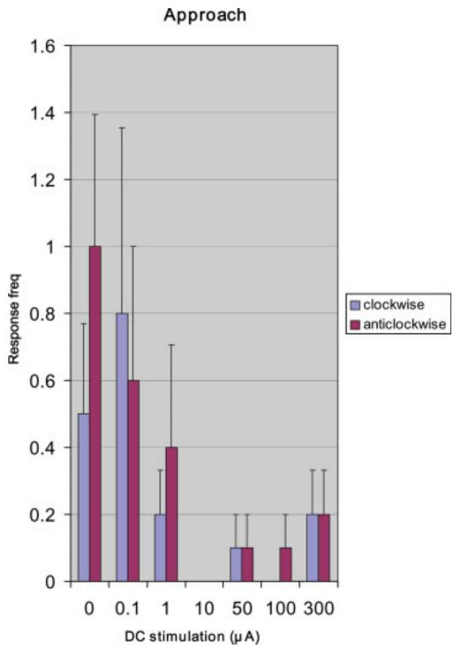
Pretectal DC generally reduces approach
The approach component of prey-catching was scored as forward movement toward the moving worm-like stimulus. McConville and Laming counted its occurrence while varying pretectal DC current and presenting the same 3 cm × 0.75 cm visual object.
Approach generally declined as current increased, with very low occurrence through much of the higher-current range. At 300 μA there was a small increase relative to the preceding high-current conditions. The published original color bars retain both directions of stimulus movement.
The overall reduction is consistent with a pretectal influence that restrains feeding-related actions. The authors attributed the small rise at 300 μA to movement accompanying a defensive stance, the current at which retreat and crouching were most frequent.
McConville & Laming (2007), Fig. 3. Lpd electrodes.
McConville & Laming (2007), Fig. 5. Approach responses generally decline as DC current increases.
McConville & Laming (2007)
41
Notes:
Teaching transcript:
The **approach** component of prey-catching was scored as forward movement toward the moving worm-like stimulus. McConville and Laming counted its occurrence while varying pretectal DC current and presenting the same 3 cm × 0.75 cm visual object.
Approach generally declined as current increased, with very low occurrence through much of the higher-current range. At 300 μA there was a small increase relative to the preceding high-current conditions. The published original color bars retain both directions of stimulus movement.
The overall reduction is consistent with a pretectal influence that restrains feeding-related actions. The nonmonotonic endpoint prevents describing the relation as a perfectly graded suppression, and an approach movement by itself does not establish the animal’s recognition of the object as edible.
The authors considered that movement at the highest current might accompany a defensive stance rather than ordinary feeding. That interpretation was proposed, not confirmed by a direct readout of stimulus identity. The measured variable is the observed approach component.
References:
McConville J, Laming PR (2007). DC electrical stimulation of the pretectal thalamus and its effects on the feeding behavior of the toad (Bufo bufo). Developmental Neurobiology 67(7):875–883. https://doi.org/10.1002/dneu.20390
McConville & Laming (2007), Fig. 5. Approach responses generally decline as DC current increases.
Figure source: https://doi.org/10.1002/dneu.20390
McConville & Laming (2007), Fig. 3. Lpd electrodes.
Figure source: https://doi.org/10.1002/dneu.20390

Slide 55
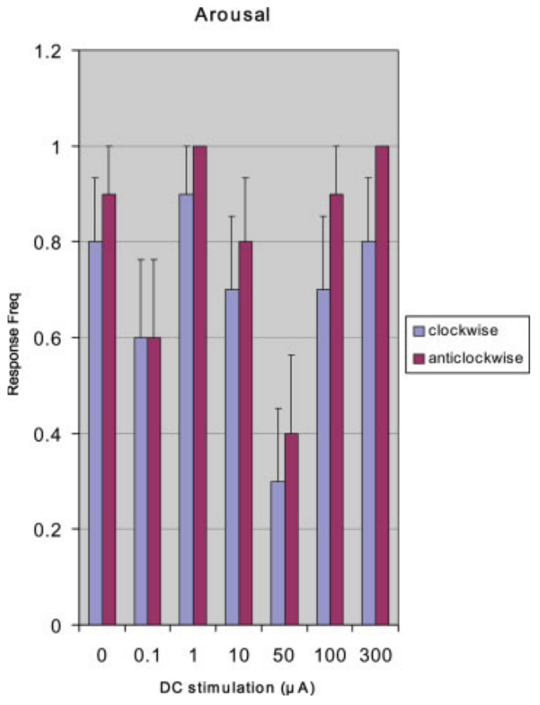
Arousal persists when approach is reduced
McConville and Laming distinguished arousal, extension of the head and forelimbs, from approach, retreat and crouching. These components separate detection-related activation from the particular direction of the animal’s subsequent movement.
Across the 0–300 μA DC range, arousal was relatively constant, although reductions occurred at 0.1 and 50 μA. Approach was reduced much more broadly as current increased. The animal could therefore remain behaviorally responsive while its prey-directed movement declined.
The dissociation argues against treating reduced approach as complete visual unresponsiveness or generalized paralysis. Arousal opens the feeding sequence of arousal, orientation, approach, fixation and snapping, so pretectal current acts after detection, at the step that commits the toad to pursuit.
McConville & Laming (2007), Fig. 3. Lpd electrodes.
McConville & Laming (2007), Fig. 4. Arousal remains relatively constant across the DC current range.
McConville & Laming (2007)
42
Notes:
Teaching transcript:
McConville and Laming distinguished **arousal**, extension of the head and forelimbs, from approach, retreat and crouching. These components separate detection-related activation from the particular direction of the animal’s subsequent movement.
Across the 0–300 μA DC range, arousal was relatively constant, although reductions occurred at 0.1 and 50 μA. Approach was reduced much more broadly as current increased. The animal could therefore remain behaviorally responsive while its prey-directed movement declined.
The dissociation argues against treating reduced approach as complete visual unresponsiveness or generalized paralysis. It does not prove that sensation was unchanged in every respect, and it does not establish whether current altered perception, action selection, motivation or several processes together.
Arousal and approach were scored separately in the same behavioral framework. A toad lifting its head or forelimbs can respond to the event without walking toward the object. Preserved arousal constrains the interpretation of reduced feeding behavior, but it is not a complete measure of visual perception.
References:
McConville J, Laming PR (2007). DC electrical stimulation of the pretectal thalamus and its effects on the feeding behavior of the toad (Bufo bufo). Developmental Neurobiology 67(7):875–883. https://doi.org/10.1002/dneu.20390
McConville & Laming (2007), Fig. 4. Arousal remains relatively constant across the DC current range.
Figure source: https://doi.org/10.1002/dneu.20390
McConville & Laming (2007), Fig. 3. Lpd electrodes.
Figure source: https://doi.org/10.1002/dneu.20390

Slide 56
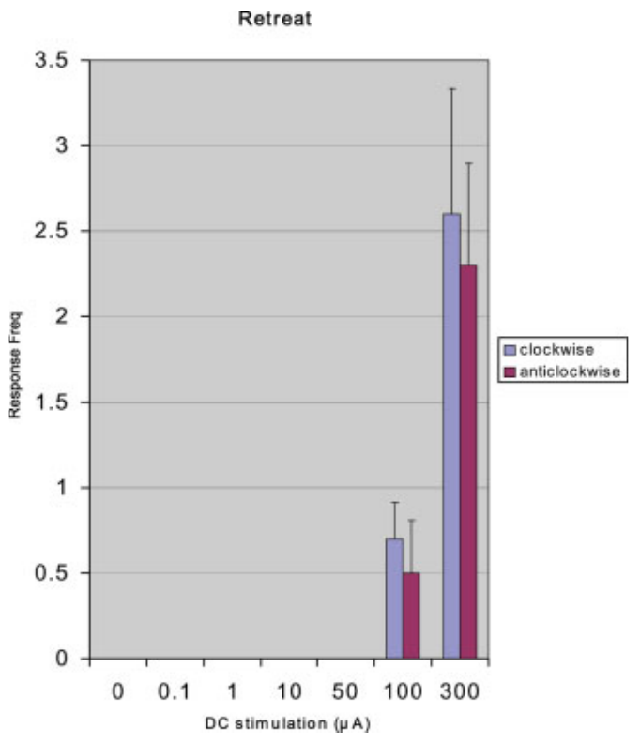
High DC current recruits retreat
Retreat was scored as backward movement away from the worm-like stimulus. McConville and Laming presented that same prey-like object during each DC condition, allowing a defensive action to emerge without substituting a larger predator-shaped visual cue.
Retreat was not observed at currents below 100 μA in the reported experiment. It appeared at 100 μA and increased at 300 μA, in the same range where prey-related approach was generally reduced. Both directions of object movement were represented in the source data.
The result supports a stimulation-dependent change in the action released by a constant visual stimulus. A prey-sized object that normally draws the toad forward instead drove it backward, the response Ewert's toads gave to large moving discs.
McConville & Laming (2007), Fig. 3. Lpd electrodes.
McConville & Laming (2007), Fig. 6. Retreat occurs at 100 and 300 μA, with both directions of visual motion.
McConville & Laming (2007)
43
Notes:
Teaching transcript:
**Retreat** was scored as backward movement away from the worm-like stimulus. McConville and Laming presented that same prey-like object during each DC condition, allowing a defensive action to emerge without substituting a larger predator-shaped visual cue.
Retreat was not observed at currents below 100 μA in the reported experiment. It appeared at 100 μA and increased at 300 μA, in the same range where prey-related approach was generally reduced. Both directions of object movement were represented in the source data.
The result supports a stimulation-dependent change in the action released by a constant visual stimulus. It does not show that the toad recognized an actual predator, and the current threshold should not be treated as a natural pretectal firing threshold.
The apparent switch is a change in observed movement toward the same cue. Electrical stimulation can bias that selection without changing the object. A behavioral response compatible with defense does not identify the internal perceptual category or the individual neurons carrying the decision.
References:
McConville J, Laming PR (2007). DC electrical stimulation of the pretectal thalamus and its effects on the feeding behavior of the toad (Bufo bufo). Developmental Neurobiology 67(7):875–883. https://doi.org/10.1002/dneu.20390
McConville & Laming (2007), Fig. 6. Retreat occurs at 100 and 300 μA, with both directions of visual motion.
Figure source: https://doi.org/10.1002/dneu.20390
McConville & Laming (2007), Fig. 3. Lpd electrodes.
Figure source: https://doi.org/10.1002/dneu.20390

Slide 57
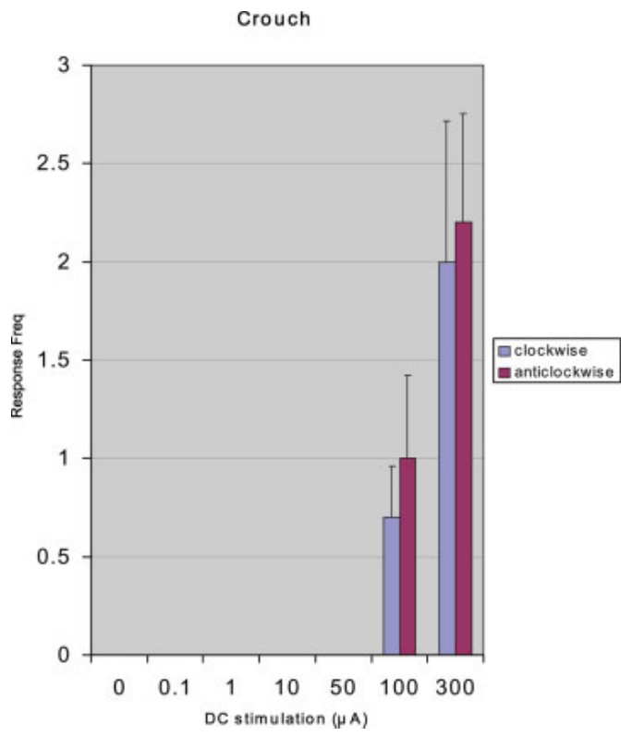
High DC current also recruits crouching
Crouching was scored as lowering the head and shoulders rather than advancing toward the object. This posture is a defensive component distinct from retreat, which changes the animal’s position by moving backward.
McConville and Laming reported no crouching below 100 μA, followed by crouch responses at 100 and 300 μA. The same moving worm-like object was present, and high-current stimulation increased both this postural response and retreat while generally reducing approach.
The coordinated behavioral changes support a shift toward defensive responding rather than a simple uniform reduction of all movement. Crouching resembles the ducking that Ewert evoked by electrically stimulating pretectal and caudal thalamic sites.
McConville & Laming (2007), Fig. 3. Lpd electrodes.
McConville & Laming (2007), Fig. 7. Crouch responses emerge at high DC currents.
McConville & Laming (2007)
44
Notes:
Teaching transcript:
**Crouching** was scored as lowering the head and shoulders rather than advancing toward the object. This posture is a defensive component distinct from retreat, which changes the animal’s position by moving backward.
McConville and Laming reported no crouching below 100 μA, followed by crouch responses at 100 and 300 μA. The same moving worm-like object was present, and high-current stimulation increased both this postural response and retreat while generally reducing approach.
The coordinated behavioral changes support a shift toward defensive responding rather than a simple uniform reduction of all movement. They do not establish that the pretectal Lpd region contains a single command neuron for crouching or that current selectively activated a naturally defined predator pathway.
A posture and a translational movement are different motor outputs. Their emergence in the same current range makes a defensive interpretation of the behavioral change more plausible than interpreting reduced approach alone. The surface stimulation remains broader than a cell-specific causal manipulation.
References:
McConville J, Laming PR (2007). DC electrical stimulation of the pretectal thalamus and its effects on the feeding behavior of the toad (Bufo bufo). Developmental Neurobiology 67(7):875–883. https://doi.org/10.1002/dneu.20390
McConville & Laming (2007), Fig. 7. Crouch responses emerge at high DC currents.
Figure source: https://doi.org/10.1002/dneu.20390
McConville & Laming (2007), Fig. 3. Lpd electrodes.
Figure source: https://doi.org/10.1002/dneu.20390

Slide 58
Defense needs more current than feeding restraint
Approach fell across a wide range of DC currents, while retreat and crouching appeared only at 100 μA and above. Two processes with different thresholds can produce this pattern: one that withholds feeding at modest pretectal activation, and one that releases defensive movement only when activation is strong.
Between the two thresholds lies a state in which the toad neither approaches nor escapes while arousal persists. Ewert's disc experiments contain a matching zone in stimulus space: orienting was nearly absent at 20°, yet avoidance became prominent only above 30°, leaving intermediate objects to release little of either.
Graded pretectal activity could therefore sort objects into three outcomes: catch, ignore and escape. A small prey object barely engages the restraint, an intermediate one withholds feeding, and a large one crosses the defensive threshold.
McConville & Laming (2007), Fig. 7. Crouch responses emerge at high DC currents.
McConville & Laming (2007); Ewert (1970)
44a
Notes:
Slides 41 to 44 report four behavioral components across the same current range; their thresholds differ, and that difference separates restraint of feeding from recruitment of defense.
Two thresholds.
Approach declined well below 100 microamperes, whereas retreat and crouching were absent until that current was reached.
If one process did both jobs, the loss of approach and the appearance of defense should begin together; their separation points to two steps.
A neutral zone.
On slide 42 arousal stays fairly constant, so in the intermediate current range the toad detects the object but neither approaches nor retreats.
Slide 2 contains a parallel in stimulus size: discs near 20 degrees released almost no orienting, while avoidance became prominent only above 30 degrees.
Three outcomes.
A graded pretectal signal with two thresholds would give feeding for weak activation, inaction for moderate activation and defense for strong activation.
This sorting is an interpretation that joins the DC and disc results; neither study recorded pretectal activity during these choices.
References:
McConville J, Laming PR (2007). DC electrical stimulation of the pretectal thalamus and its effects on the feeding behavior of the toad (Bufo bufo). Developmental Neurobiology 67(7):875–883. https://doi.org/10.1002/dneu.20390
Ewert JP (1970). Neural mechanisms of prey-catching and avoidance behavior in the toad (Bufo bufo L.). Brain, Behavior and Evolution 3(1–4):36–56. https://doi.org/10.1159/000125462

Slide 59
Glial potassium modulation remains a proposed mechanism
McConville and Laming proposed that DC stimulation could generate slow potential shifts associated with redistribution of potassium ions. Glia are non-neuronal cells that regulate the environment around neurons; their discussion emphasized radial glial processes in amphibian tissue.
Increasing extracellular potassium can bring neuronal membrane voltage closer to spike threshold and thereby increase excitability. The authors suggested that such modulation might prime pretectal nonprey-responsive cells and increase restraint of tectal feeding-related activity. Their behavioral effect included crouching only at currents of 100 μA and above.
McConville & Laming (2007), Fig. 7. Crouch responses emerge at high DC currents.
In potassium spatial buffering, glial cells take up potassium where neurons release it and discharge it elsewhere through their processes. Altering that redistribution would change how readily pretectal neurons reach threshold, and with it their restraint of tectal feeding activity.
McConville & Laming (2007), Fig. 3. Lpd electrodes.
McConville & Laming (2007)
45
Notes:
Teaching transcript:
McConville and Laming proposed that DC stimulation could generate slow potential shifts associated with redistribution of potassium ions. **Glia** are non-neuronal cells that regulate the environment around neurons; their discussion emphasized radial glial processes in amphibian tissue.
Increasing extracellular potassium can bring neuronal membrane voltage closer to spike threshold and thereby increase excitability. The authors suggested that such modulation might prime pretectal nonprey-responsive cells and increase restraint of tectal feeding-related activity. Their behavioral effect included crouching only at currents of 100 μA and above.
The experiment did not directly measure potassium redistribution, glial currents, TH3-cell firing or a particular potassium channel. The ion-based account is an explanatory hypothesis for a measured behavioral change, rather than an established molecular sequence for predator avoidance.
TH3 is a physiological designation for pretectal cells responsive to large moving or nonprey configurations, as discussed in the paper’s background. The DC behavioral experiment did not record those cells. No channel name or receptor subtype can be inferred simply from the observed current-dependent behavior.
References:
McConville J, Laming PR (2007). DC electrical stimulation of the pretectal thalamus and its effects on the feeding behavior of the toad (Bufo bufo). Developmental Neurobiology 67(7):875–883. https://doi.org/10.1002/dneu.20390
McConville & Laming (2007), Fig. 7. Crouch responses emerge at high DC currents.
Figure source: https://doi.org/10.1002/dneu.20390
McConville & Laming (2007), Fig. 3. Lpd electrodes.
Figure source: https://doi.org/10.1002/dneu.20390

Slide 60
Key takeaways
Pretectal restraint. Effective pretectal and caudal thalamic damage releases catching toward large or unsuitable objects; preserved snapping separates this effect from loss of the motor capacity.
Selectivity and excitability. Configuration filtering and response strength are distinct: some cuts increase firing without eliminating the worm–antiworm distinction.
Timed input interaction. Pretectal conditioning strongly attenuates an early optic-nerve-evoked tectal component at a lead of approximately 17–25 ms; adaptation controls support a pathway-specific effect.
Distinct electrical measurements. Unit spikes, EEG and slow extracellular potentials measure different activity; more firing can coexist with a smaller population field.
NPY evidence. Local NPY reduces the negative tectal field component, but receptor identity, endogenous release and necessity for avoidance were not established by the application experiment.
Behavioral bias and molecular limits. High pretectal DC recruits retreat and crouching while generally reducing approach; glial potassium modulation remains a proposed explanation rather than a measured pathway.
Ewert (1970); Ingle (1973); Laming & Ewert (1983); Schwippert et al. (1995); Schwippert & Ewert (1995); McConville & Laming (2007)
46
Notes:
Teaching transcript:
Pretectal restraint. Effective pretectal and caudal thalamic damage releases catching toward large or unsuitable objects; preserved snapping separates this effect from loss of the motor capacity.
Selectivity and excitability. Configuration filtering and response strength are distinct: some cuts increase firing without eliminating the worm–antiworm distinction.
Timed input interaction. Pretectal conditioning strongly attenuates an early optic-nerve-evoked tectal component at a lead of approximately 17–25 ms; adaptation controls support a pathway-specific effect.
Distinct electrical measurements. Unit spikes, EEG and slow extracellular potentials measure different activity; more firing can coexist with a smaller population field.
NPY evidence. Local NPY reduces the negative tectal field component, but receptor identity, endogenous release and necessity for avoidance were not established by the application experiment.
Behavioral bias and molecular limits. High pretectal DC recruits retreat and crouching while generally reducing approach; glial potassium modulation remains a proposed explanation rather than a measured pathway.
References:
Ewert JP (1970). Neural mechanisms of prey-catching and avoidance behavior in the toad (Bufo bufo L.). Brain, Behavior and Evolution 3(1–4):36–56. https://doi.org/10.1159/000125462
Ingle D (1973). Disinhibition of tectal neurons by pretectal lesions in the frog. Science 180(4084):422–424. https://doi.org/10.1126/science.180.4084.422
Laming PR, Ewert JP (1983). The effects of pretectal lesions on neuronal, sustained potential shift and electroencephalographic responses of the toad tectum to presentation of a visual stimulus. Comparative Biochemistry and Physiology Part A: Physiology 76(2):247–252. https://doi.org/10.1016/0300-9629(83)90322-5
Schwippert WW, Beneke TW, Ewert JP (1995). Pretecto-tectal influences. II. How retinal and pretectal inputs to the toad’s superficial tectum interact: a study of electrically evoked field potentials. Journal of Comparative Physiology A 176(2):181–192. https://doi.org/10.1007/BF00239921
Schwippert WW, Ewert JP (1995). Effect of neuropeptide-Y on tectal field potentials in the toad. Brain Research 669(1):150–152. https://doi.org/10.1016/0006-8993(94)01260-O
McConville J, Laming PR (2007). DC electrical stimulation of the pretectal thalamus and its effects on the feeding behavior of the toad (Bufo bufo). Developmental Neurobiology 67(7):875–883. https://doi.org/10.1002/dneu.20390

