Slide 1
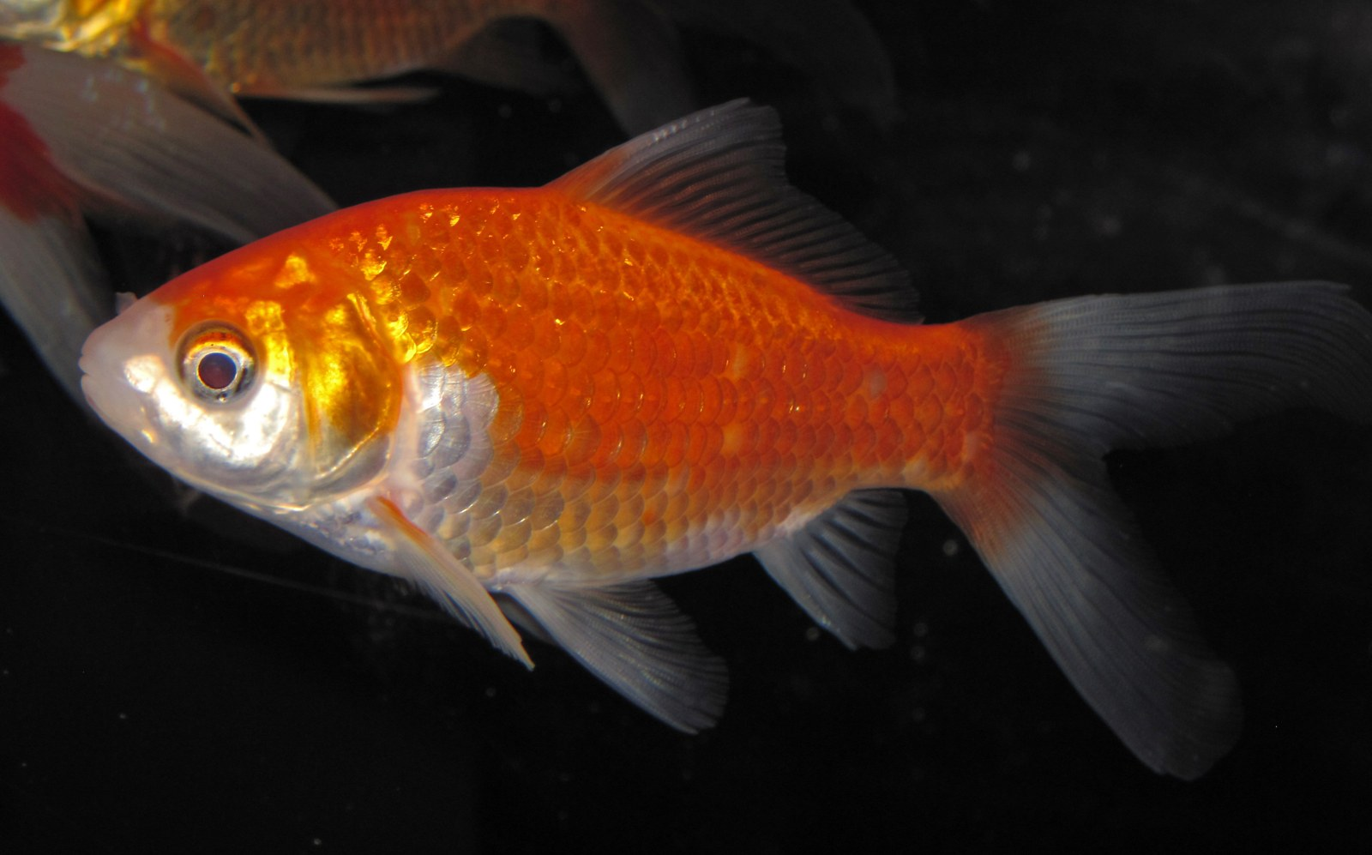
NEUR 411 · NEUROETHOLOGY · FALL 2026
Lecture 5
Fish startle:
the Mauthner cell and the C-start response (Eaton & Faber)
Wednesday, September 2, 2026
Jordan Lopez, Ph.D.
Professor of Neurobiology & Biomedical Engineering
Photo: Goldfish (Carassius auratus), the classic species for Mauthner-cell physiology.
Notes:
Fish startle: the Mauthner cell and the C-start response (Eaton & Faber)
Lecture 5. NEUR 411 · NEUROETHOLOGY · FALL 2026. Wednesday, September 2, 2026.
Image: Photo: Goldfish (Carassius auratus), the classic species for Mauthner-cell physiology. Credit: James St. John. License: CC BY 2.0. Source: https://commons.wikimedia.org/wiki/File:Carassius_auratus_auratus_(goldfish)_1.jpg

Slide 2
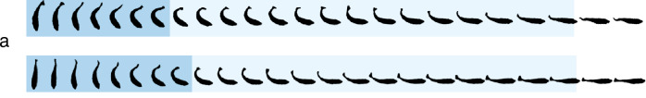
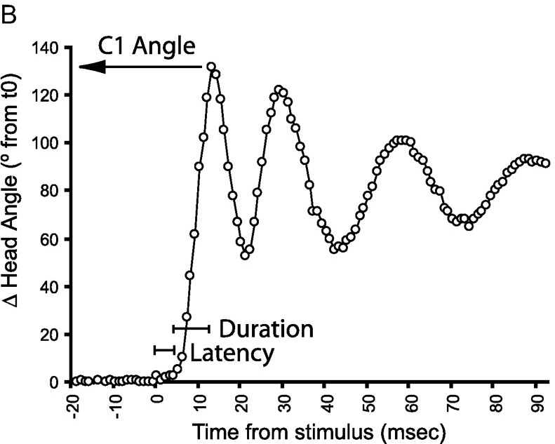
A C-start bends the body into a C, then drives it away
The C-start is a fast escape in which a fish bends its body into the shape of a letter C and then accelerates away. Eaton and colleagues filmed it at 200 frames per second in 11 of 13 teleost species that possess Mauthner cells; the response began 5–10 ms after a vibrational stimulus.
Stage 1, the fast body bend, lasts about 20 ms and moves the head and tail to the same side. Stage 2 is a flip of the tail to the opposite side that propels the fish. Within 100 ms most fish had moved 0.5–1.5 body lengths, and where they ended up varied from trial to trial.
In goldfish, stage 1 rotates the body 30–100° about its center of mass in 15–40 ms, and stage 2 moves the center of mass 2–6 cm. A larval zebrafish C-start has the same structure: the head angle swings to a peak within about 10 ms of the stimulus.
Schuster (2023), Fig. 2a. Archerfish C-starts at 500 frames/s; dark blue marks the initial C-bend, light blue the straightening phase.
Burgess & Granato (2007), Fig. 1B. Head angle of a larval zebrafish after an acoustic stimulus, with latency, duration and C1 angle marked.
Eaton et al. (1977); Eaton et al. (1988); Schuster (2023)
02
Notes:
• A C-start is the escape a fish makes when something abrupt happens beside it: the body folds into a C, and then the fish shoots off.
– Eaton and colleagues filmed this response at 200 frames per second in 11 of the 13 teleost species they tested that have Mauthner cells.
– The response started only 5 to 10 milliseconds after a vibration.
• They divided it into two phases.
– Stage 1, the fast body bend, takes about 20 milliseconds, and the head and tail swing to the same side, so the body curls.
– Stage 2 is the return flip of the tail to the other side, and that stroke drives the fish forward.
• Within 100 milliseconds most fish had moved half a body length to one and a half body lengths, and their final positions differed from trial to trial.
– Eaton proposed that this variability makes the escape hard for a predator to anticipate.
• In goldfish, the stage 1 rotation ranges from about 30 to 100 degrees about the center of mass, and stage 2 carries the center of mass 2 to 6 centimeters. The archerfish frames and the larval zebrafish head-angle trace both have this same bend-then-propel sequence.
References:
Eaton RC, Bombardieri RA, Meyer DL (1977). The Mauthner-initiated startle response in teleost fish. Journal of Experimental Biology 66: 65–81. https://doi.org/10.1242/jeb.66.1.65
Eaton RC, DiDomenico R, Nissanov J (1988). Flexible body dynamics of the goldfish C-start: implications for reticulospinal command mechanisms. Journal of Neuroscience 8(8): 2758–2768. https://doi.org/10.1523/JNEUROSCI.08-08-02758.1988
Schuster S (2023). The archerfish predictive C-start. Journal of Comparative Physiology A 209(5): 827–837. https://doi.org/10.1007/s00359-023-01658-2
Burgess HA, Granato M (2007). Sensorimotor gating in larval zebrafish. Journal of Neuroscience 27(18): 4984–4994. https://doi.org/10.1523/JNEUROSCI.0615-07.2007
Figure: Schuster (2023), Fig. 2a. Archerfish C-starts at 500 frames/s; dark blue marks the initial C-bend, light blue the straightening phase.
Figure source: https://doi.org/10.1007/s00359-023-01658-2
Figure: Burgess & Granato (2007), Fig. 1B. Head angle of a larval zebrafish after an acoustic stimulus, with latency, duration and C1 angle marked.
Figure source: https://doi.org/10.1523/JNEUROSCI.0615-07.2007

Slide 3
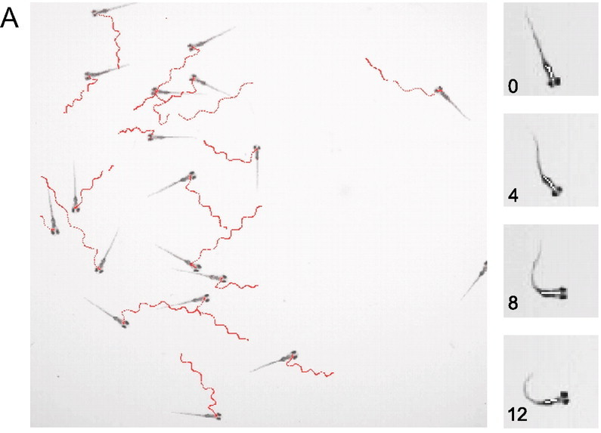
Larval zebrafish startle within milliseconds of a tap
Burgess and Granato tracked the acoustic startle response of many 6-day-old zebrafish larvae at once. An acoustic/vibrational tap was delivered to the dish, and a high-speed camera recorded every larva's position and head orientation.
The startle consists of a sharp C1 bend of the head and trunk away from the initial heading, followed by counter-bends. From the head-angle record the software measures three quantities: the latency to movement onset, the duration of the first bend, and the C1 angle, the peak change in head orientation.
Automated tracking turned the startle into a high-throughput assay: thousands of trials could be scored, which made genetic screens for startle and its regulation possible. Eaton had already reported that goldfish also produce Mauthner-initiated startles to visual stimuli, so the behavior is not restricted to sound.
Burgess & Granato (2007), Fig. 1A. Tracks of 18 larvae (6 dpf) after an acoustic/vibrational stimulus (red) and frames of one startle at 0–12 ms.
Burgess & Granato (2007); Eaton et al. (1977)
03
Notes:
• Burgess and Granato built a system that films many zebrafish larvae at the same time and measures each fish's startle automatically.
– The larvae are six days old, small enough that dozens swim in one dish under a high-speed camera.
– A tap on the dish delivers an acoustic and vibrational stimulus, and the tracks record each larva's path afterward.
• The startle is a sharp first bend, called C1, followed by smaller bends to alternate sides.
– From the change in head angle over time the software extracts the latency, the duration of the first bend, and the C1 angle, the size of that first turn.
• Because each trial is scored automatically, the experimenters could analyze thousands of startles, and that throughput is what allowed later screens for genes that change startle behavior.
– Eaton's earlier work in goldfish had found that a visual stimulus can also elicit a Mauthner-initiated startle, so the circuit responds to more than sound.
References:
Burgess HA, Granato M (2007). Sensorimotor gating in larval zebrafish. Journal of Neuroscience 27(18): 4984–4994. https://doi.org/10.1523/JNEUROSCI.0615-07.2007
Eaton RC, Bombardieri RA, Meyer DL (1977). The Mauthner-initiated startle response in teleost fish. Journal of Experimental Biology 66: 65–81. https://doi.org/10.1242/jeb.66.1.65
Figure: Burgess & Granato (2007), Fig. 1A. Tracks of 18 larvae (6 dpf) after an acoustic/vibrational stimulus (red) and frames of one startle at 0–12 ms.
Figure source: https://doi.org/10.1523/JNEUROSCI.0615-07.2007

Slide 4
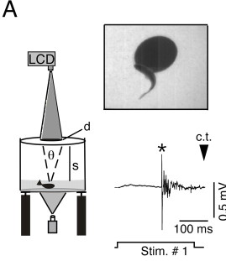
One Mauthner spike precedes the contralateral muscle burst
Zottoli implanted fine electrodes next to one Mauthner cell (M-cell) in goldfish that then swam freely, and recorded the M-cell's extracellular spike together with the electromyogram (EMG), the electrical activity of trunk muscle, during startles to a brief 200 Hz sound.
In every one of 34 startles in which the recorded M-cell lay on the side opposite the contracting muscle, a single M-cell spike preceded the EMG by about 1–2 ms. When the recorded cell was on the same side as the contracting muscle, it fired in only one of 39 startles, and it never fired when the fish did not startle.
Each M-cell therefore drives contraction of the opposite side of the body. Preuss and colleagues later recorded the same single M-axon spike before visually evoked C-starts, with later impulses attributed to other reticulospinal neurons.
Preuss et al. (2006), Fig. 1A. Looming disk projected above a goldfish, a visually evoked C-start, and a single M-axon spike (*) before it.
Zottoli (1977); Preuss et al. (2006)
04
Notes:
• Zottoli's experiment linked one neuron to one behavior in an animal that was free to move.
– He implanted electrodes beside one Mauthner cell in a goldfish, let the fish swim, and played brief 200 hertz sounds while recording the cell and the trunk muscles.
• The result was very consistent.
– Whenever the recorded Mauthner cell was on the side opposite the muscles that contracted, it fired a single spike about one to two milliseconds before the muscle activity began, in all 34 such startles.
– When the recorded cell was on the same side as the contracting muscles, it fired in only one of 39 startles, and on trials without a startle it stayed silent.
• Each Mauthner cell therefore commands a bend toward the opposite side, and one spike is enough. Preuss and colleagues found the same single Mauthner-axon spike before C-starts triggered by an expanding visual disk.
References:
Zottoli SJ (1977). Correlation of the startle reflex and Mauthner cell auditory responses in unrestrained goldfish. Journal of Experimental Biology 66: 243–254. https://doi.org/10.1242/jeb.66.1.243
Preuss T, Osei-Bonsu PE, Weiss SA, Wang C, Faber DS (2006). Neural representation of object approach in a decision-making motor circuit. Journal of Neuroscience 26(13): 3454–3464. https://doi.org/10.1523/JNEUROSCI.5259-05.2006
Figure: Preuss et al. (2006), Fig. 1A. Looming disk projected above a goldfish, a visually evoked C-start, and a single M-axon spike (*) before it.
Figure source: https://doi.org/10.1523/JNEUROSCI.5259-05.2006

Slide 5
Few synapses, electrical links and a wide axon buy speed
Every chemical synapse adds delay while transmitter is released, crosses the cleft and opens receptors. From an auditory afferent to a trunk motoneuron, the Mauthner route has only two synapses: the club ending onto the M-cell and the M-axon's contact in the spinal cord.
Marquart and colleagues attribute the speed of this route to three features: the short pathway, electrical transmission at the club endings, and the large caliber of the M-axon. A wide axon has low internal resistance, so current spreads farther inside it before leaking out, each stretch of membrane reaches threshold sooner, and the impulse travels faster.
Speed also shapes the movement. A fast impulse reaches the last trunk segments just after the first, so one side contracts almost at once and folds the body into a C, not a traveling wave. Weiss and colleagues report an M-cell spike as little as 2.2 ms after the onset of an abrupt sound.
Preuss et al. (2006), Fig. 1A. Looming disk projected above a goldfish, a visually evoked C-start, and a single M-axon spike (*) before it.
Marquart et al. (2019); Fetcho & Faber (1988); Weiss et al. (2008)
04a
Notes:
• The single spike on slide 4 precedes the muscle burst by only one to two milliseconds, and the reason the whole reflex is so fast lies in how few steps separate the ear from the muscle.
• Synapses are the slow steps.
– At a chemical synapse the presynaptic spike has to open calcium channels and trigger vesicle fusion, and the released glutamate has to diffuse and bind before any current flows in the target.
– The Mauthner circuit keeps these steps to a minimum: one synapse from afferent to M-cell, one from M-axon to motoneuron, as Fetcho and Faber established for the spinal side on slide 12.
• Marquart and colleagues list three reasons for the short reaction time.
– The pathway is short, the club endings on slide 14 transmit electrically with essentially no delay, and the axon is very wide.
– Axon width matters because internal resistance falls as the cross-section grows, so injected current travels farther along the inside before it escapes, and conduction velocity rises.
• Conduction speed also allows the body to bend as one piece.
– If the impulse crept slowly down the cord, anterior segments would contract long before posterior ones, producing an undulation like a swimming stroke.
– Weiss and colleagues place the M-spike within about two milliseconds of an abrupt sound, so the stage 1 bend on slide 2 begins only a few milliseconds after the stimulus.
References:
Marquart GD, Tabor KM, Bergeron SA, Briggman KL, Burgess HA (2019). Prepontine non-giant neurons drive flexible escape behavior in zebrafish. PLoS Biology 17(10): e3000480. https://doi.org/10.1371/journal.pbio.3000480
Fetcho JR, Faber DS (1988). Identification of motoneurons and interneurons in the spinal network for escapes initiated by the Mauthner cell in goldfish. Journal of Neuroscience 8(11): 4192–4213. https://doi.org/10.1523/JNEUROSCI.08-11-04192.1988
Weiss SA, Preuss T, Faber DS (2008). A role of electrical inhibition in sensorimotor integration. Proceedings of the National Academy of Sciences USA 105(46): 18047–18052. https://doi.org/10.1073/pnas.0806145105
Zottoli SJ (1977). Correlation of the startle reflex and Mauthner cell auditory responses in unrestrained goldfish. Journal of Experimental Biology 66: 243–254. https://doi.org/10.1242/jeb.66.1.243

Slide 6
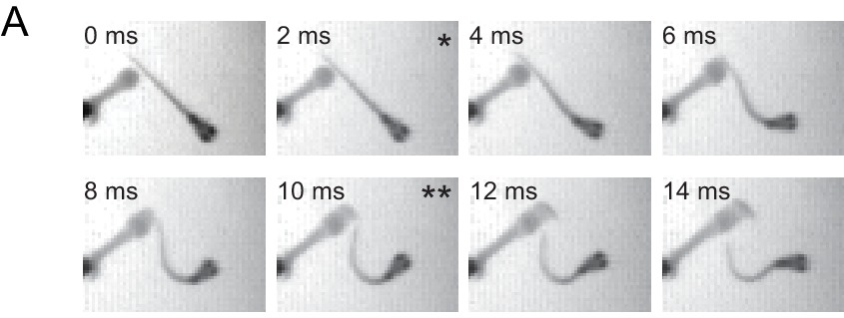
Stage 1 angle varies, so the C-start is not a fixed pattern
Eaton, DiDomenico and Nissanov evoked goldfish C-starts with water displacements of only 3–6 µm and filmed them while recording trunk EMGs. The combined turn over stages 1 and 2 ranged from 15° to 135°, so the C-start is graded rather than a fixed movement.
The duration of the stage 1 EMG was correlated with the stage 1 turn angle. Triggering the M-cell by itself does not produce this variable EMG, so circuits other than the M-cell must set how far the fish turns.
The stage 1 and stage 2 angles were correlated, and the final trajectory could be predicted on average 26 ms after movement began. The stage 2 EMG usually started near the onset of stage 1 movement, so stage 2 is commanded before feedback from the bend is available. The M-cell starts the escape and fixes its side, and parallel circuits set its angle.
Koyama et al. (2016), Fig. 9A. Larval zebrafish escaping a squirt of water: bend onset (*) and peak initial bend at 10 ms (**).
Eaton et al. (1988); Koyama et al. (2016)
05
Notes:
• The 1988 study asked whether the C-start is one stereotyped motor program or a family of movements.
– Tiny water displacements, only 3 to 6 micrometers, were enough to trigger escapes in goldfish, and the fish turned anywhere from 15 to 135 degrees.
• Muscle recordings explained part of that range.
– The longer the stage 1 muscle burst, the larger the stage 1 turn.
– Stimulating the Mauthner cell alone gives a fixed muscle burst, so the extra, variable part of the command has to come from other neurons.
• Stage 2 was already planned during stage 1.
– The trajectory could be predicted about 26 milliseconds after movement began, and the stage 2 muscle activity typically started near the beginning of stage 1, before any sensory feedback about the bend could arrive.
– Eaton concluded that the Mauthner cell initiates the escape and determines its side, while parallel reticulospinal circuits organize the escape angle.
• The larval frames, from a squirt of water at the side, have the same rapid C-bend, peaking about 10 milliseconds after the first movement.
References:
Eaton RC, DiDomenico R, Nissanov J (1988). Flexible body dynamics of the goldfish C-start: implications for reticulospinal command mechanisms. Journal of Neuroscience 8(8): 2758–2768. https://doi.org/10.1523/JNEUROSCI.08-08-02758.1988
Koyama M, Minale F, Shum J, Nishimura N, Schaffer CB, Fetcho JR (2016). A circuit motif in the zebrafish hindbrain for a two alternative behavioral choice to turn left or right. eLife 5: e16808. https://doi.org/10.7554/eLife.16808
Figure: Koyama et al. (2016), Fig. 9A. Larval zebrafish escaping a squirt of water: bend onset (*) and peak initial bend at 10 ms (**).
Figure source: https://doi.org/10.7554/eLife.16808

Slide 7
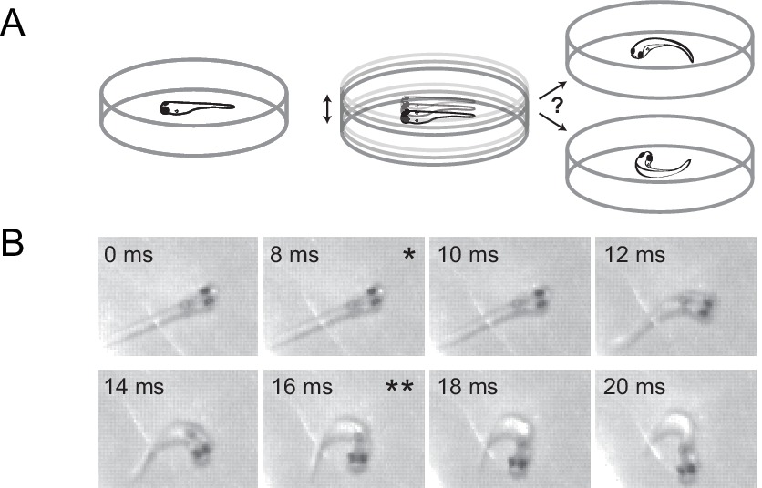
Stimulus direction sets the escape, and the turn is ballistic
Eaton and Emberley dropped a ball into the water near goldfish and filmed the C-starts. The angle turned in stage 1 varied inversely with the direction of the ball's impact relative to the fish, so the stimulus direction sets the escape trajectory.
Fish starting near a wall chose an escape route that could not be predicted from the stimulus angle alone, and fish that began turning toward the ball did not correct their path. The command is therefore ballistic: once the movement starts, it no longer uses sensory information about the stimulus, and any information about obstacles must be used before the trigger.
Foreman and Eaton found that trajectory is set by the relative size of the agonist and antagonist muscle contractions on the two sides and by their timing. No separate signal controls forward force; force is embedded in the command that bends the body.
Koyama et al. (2016), Fig. 10A–B. A dish is vibrated under a free larva; frames of an escape to the right from start (*) to end (**) of the initial bend.
Eaton & Emberley (1991); Foreman & Eaton (1993); Koyama et al. (2016)
06
Notes:
• Eaton and Emberley used a falling ball as a natural threat and asked how its direction changed the escape.
– The farther around the fish the impact was, the more the stage 1 angle changed, an inverse relationship between impact direction and turn angle.
• Two observations pointed to a ballistic command.
– Near a wall, fish took escape routes that the stimulus angle alone did not predict, so they must have used information about the wall gathered before the stimulus.
– Fish that began turning toward the ball never corrected the turn, so once the escape starts, information about the stimulus is not used to steer.
• Foreman and Eaton then related muscle activity to trajectory.
– The angle depended on how strongly the muscles on the bending side contracted compared with the opposite side, and on the timing between them.
– They found no separate command for forward thrust; the push comes from the same commands that bend the body.
References:
Eaton RC, Emberley DS (1991). How stimulus direction determines the trajectory of the Mauthner-initiated escape response in a teleost fish. Journal of Experimental Biology 161: 469–487. https://doi.org/10.1242/jeb.161.1.469
Foreman MB, Eaton RC (1993). The direction change concept for reticulospinal control of goldfish escape. Journal of Neuroscience 13(10): 4101–4113. https://doi.org/10.1523/JNEUROSCI.13-10-04101.1993
Koyama M, Minale F, Shum J, Nishimura N, Schaffer CB, Fetcho JR (2016). A circuit motif in the zebrafish hindbrain for a two alternative behavioral choice to turn left or right. eLife 5: e16808. https://doi.org/10.7554/eLife.16808
Figure: Koyama et al. (2016), Fig. 10A–B. A dish is vibrated under a free larva; frames of an escape to the right from start (*) to end (**) of the initial bend.
Figure source: https://doi.org/10.7554/eLife.16808

Slide 8
The M-cell picks the side; other neurons set the angle
The C-start joins an all-or-none decision to graded control. Which M-cell fires settles whether and toward which side the fish bends, and its single spike is the same every time. The size of the turn varies, so it must come from neurons whose firing can last longer or shorter.
Foreman and Eaton tie the angle to the balance between the agonist muscles on the bending side and the antagonist muscles opposite, and to the delay between them. The homologs MiD2cm and MiD3cm, which fire trains whose rate grows with input, have the kind of output that could grade these bursts.
The command is assembled almost before movement starts: the stage 2 burst begins about 28 ms ahead of stage 2 movement. Foreman and Eaton argue that setting only the size and timing of opposing contractions allows the fish to exploit its muscle mechanics and shorten its motor computation.
Koyama et al. (2016), Fig. 10A–B. A dish is vibrated under a free larva; frames of an escape to the right from start (*) to end (**) of the initial bend.
Eaton et al. (1988); Foreman & Eaton (1993); Watanabe et al. (2017)
06a
Notes:
• Slides 4 to 6 contain a puzzle: one M-cell spike is identical on every trial, yet the escape angle ranges widely. The resolution is that deciding and steering are carried by different neurons.
• The decision is binary.
– Zottoli's recordings on slide 4 tie each escape to one spike in the M-cell opposite the contracting muscle, and a single spike carries no information about how large the turn should be.
– Eaton's group therefore assigned the M-cell to initiation and the choice of side, leaving the angle to other circuits.
• The angle is a matter of muscle balance.
– Foreman and Eaton recorded trunk EMG on both sides and found that trajectory depends on how strongly each side contracts relative to the other and on the interval between them.
– They found no separate signal for forward force, so the same two variables, size and timing, also determine propulsion.
• Candidates for the graded signal sit in the neighboring segments.
– Slide 13 describes MiD2cm and MiD3cm as cells that fire repetitively, with rate tracking stimulus strength, which is the property a graded command requires.
– Eaton's EMG timing places the stage 2 command early, roughly 28 milliseconds before stage 2 movement begins, so there is no time for feedback from the bend to shape it.
References:
Eaton RC, DiDomenico R, Nissanov J (1988). Flexible body dynamics of the goldfish C-start: implications for reticulospinal command mechanisms. Journal of Neuroscience 8(8): 2758–2768. https://doi.org/10.1523/JNEUROSCI.08-08-02758.1988
Foreman MB, Eaton RC (1993). The direction change concept for reticulospinal control of goldfish escape. Journal of Neuroscience 13(10): 4101–4113. https://doi.org/10.1523/JNEUROSCI.13-10-04101.1993
Watanabe T, Shimazaki T, Oda Y (2017). Coordinated expression of two types of low-threshold K+ channels establishes unique single spiking of Mauthner cells among segmentally homologous neurons in the zebrafish hindbrain. eNeuro 4(5): ENEURO.0249-17.2017. https://doi.org/10.1523/ENEURO.0249-17.2017

Slide 9
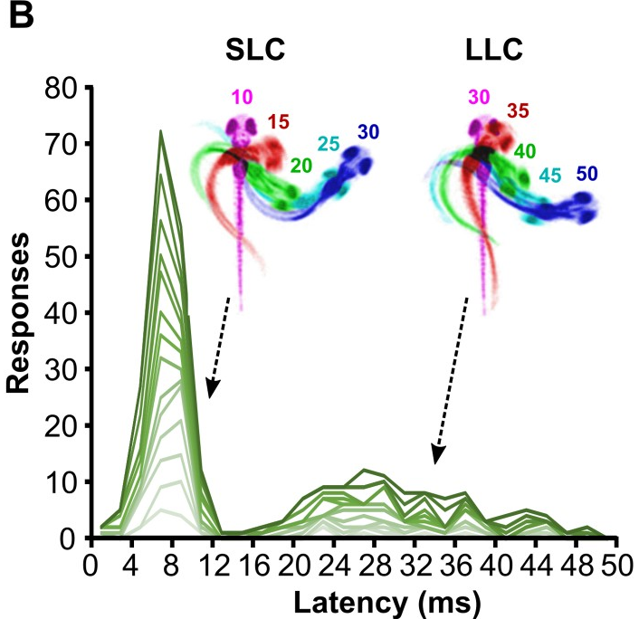
Larvae make short-latency and long-latency C-bends
Across nearly 20,000 startle trials, Burgess and Granato found that larval response latencies were biphasic. About 79% of responses began within 12 ms, and the rest formed a second wave peaking near 22 ms.
They named the two types short-latency C-bends (SLCs) and long-latency C-bends (LLCs). SLCs had larger initial bends and faster angular velocities: on average about 105° at 22.5°/ms, compared with about 75° at 11.8°/ms for LLCs. Individual larvae produced both types, so the distinction is between behaviors, not between fish.
Marquart and colleagues imaged groups of 6-day-old larvae at 1,000 frames per second. The same two peaks appeared in the latency histogram, near 8 ms and between about 20 and 40 ms. Overlaid frames, color-coded by time, trace an SLC curling within 10–30 ms and an LLC developing over 30–50 ms.
Marquart et al. (2019), Fig. 1B. Latency histograms for 15 individual larvae; insets overlay an SLC and an LLC, color-coded by ms after the stimulus.
Burgess & Granato (2007); Marquart et al. (2019)
07
Notes:
• When Burgess and Granato plotted the latency of every startle, the histogram had two humps instead of one.
– Most responses, about 79 percent, began within 12 milliseconds.
– The rest formed a smaller second wave that peaked around 22 milliseconds.
• They called these short-latency C-bends, or SLCs, and long-latency C-bends, or LLCs.
– SLCs are stronger and faster: the first bend averaged about 105 degrees at about 22 degrees per millisecond, while LLCs averaged about 75 degrees at about 12 degrees per millisecond.
– The same larva could produce both types, so these are two kinds of behavior, not two kinds of fish.
• Marquart and colleagues recorded the same two-peaked distribution with a camera running at 1,000 frames per second, and their color-coded overlays trace the timing of each bend millisecond by millisecond.
References:
Burgess HA, Granato M (2007). Sensorimotor gating in larval zebrafish. Journal of Neuroscience 27(18): 4984–4994. https://doi.org/10.1523/JNEUROSCI.0615-07.2007
Marquart GD, Tabor KM, Bergeron SA, Briggman KL, Burgess HA (2019). Prepontine non-giant neurons drive flexible escape behavior in zebrafish. PLoS Biology 17(10): e3000480. https://doi.org/10.1371/journal.pbio.3000480
Figure: Marquart et al. (2019), Fig. 1B. Latency histograms for 15 individual larvae; insets overlay an SLC and an LLC, color-coded by ms after the stimulus.
Figure source: https://doi.org/10.1371/journal.pbio.3000480

Slide 10
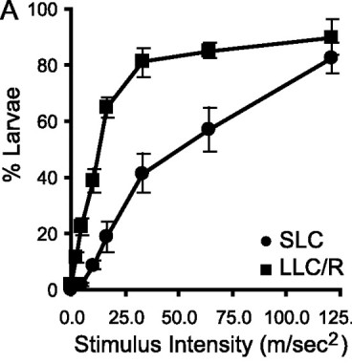
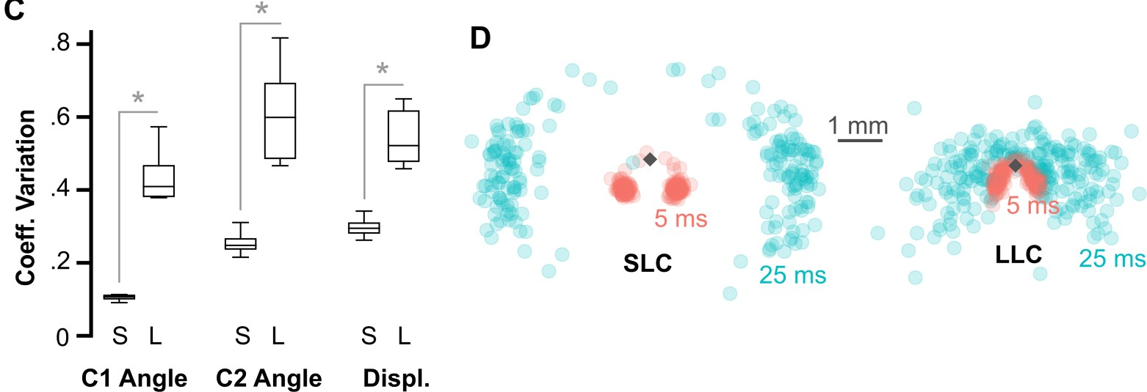
Long-latency escapes have a lower threshold and vary more
The two startle types differ in how much stimulus they need. As tap intensity increased, the fraction of larvae performing LLCs rose steeply at low intensities, whereas SLCs needed stronger stimuli and rose more gradually. Weak stimuli therefore evoke LLCs, and strong stimuli recruit SLCs.
Marquart and colleagues quantified how variable each response was. The coefficient of variation, the spread of a measure relative to its average, was much larger for LLCs in the first bend angle, the second bend angle and the displacement.
Plotting head positions 5 and 25 ms after the stimulus, SLC trajectories formed two tight clusters to the left and right, whereas LLC trajectories spread out in many directions. SLCs are stereotyped, ballistic escapes; LLCs are slower but more flexible in where they carry the fish. Marquart proposed that less precipitous threats elicit these delayed, flexible escapes.
Burgess & Granato (2007), Fig. 3A. Fraction of larvae responding with SLCs and LLCs as stimulus intensity increases.
Marquart et al. (2019), Fig. 1C–D. Variability of SLC (S) and LLC (L) kinematics and head positions 5 ms and 25 ms after the stimulus.
Burgess & Granato (2007); Marquart et al. (2019)
08
Notes:
• The two startle types also differ in threshold, the stimulus strength needed to trigger them.
– As Burgess and Granato increased the strength of the tap, long-latency C-bends appeared at low intensities and quickly reached most larvae.
– Short-latency C-bends needed stronger taps and climbed more slowly.
• Marquart and colleagues compared how variable each type was.
– They used the coefficient of variation, which is the spread of a measurement divided by its average, so that measures of different size can be compared.
– For the first bend angle, the second bend angle and the distance traveled, LLCs were much more variable than SLCs.
• Where the fish ended up made the same point.
– Short-latency escapes sent the head into two tight clusters, one to each side, while long-latency escapes scattered the fish in many directions.
– The authors proposed that weaker, less urgent threats call for this delayed escape, whose path can be adjusted.
References:
Burgess HA, Granato M (2007). Sensorimotor gating in larval zebrafish. Journal of Neuroscience 27(18): 4984–4994. https://doi.org/10.1523/JNEUROSCI.0615-07.2007
Marquart GD, Tabor KM, Bergeron SA, Briggman KL, Burgess HA (2019). Prepontine non-giant neurons drive flexible escape behavior in zebrafish. PLoS Biology 17(10): e3000480. https://doi.org/10.1371/journal.pbio.3000480
Figure: Burgess & Granato (2007), Fig. 3A. Fraction of larvae responding with SLCs and LLCs as stimulus intensity increases.
Figure source: https://doi.org/10.1523/JNEUROSCI.0615-07.2007
Figure: Marquart et al. (2019), Fig. 1C–D. Variability of SLC (S) and LLC (L) kinematics and head positions 5 ms and 25 ms after the stimulus.
Figure source: https://doi.org/10.1371/journal.pbio.3000480

Slide 11
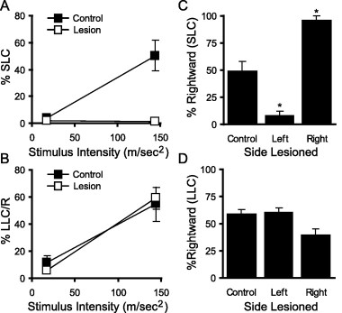
Mauthner cells are required for short-latency C-bends
Burgess and Granato killed both M-cells with a laser and tested the larvae one and two days later. Short-latency C-bends disappeared, whereas killing other randomly chosen reticulospinal neurons left them intact. Long-latency C-bends were unaffected by M-cell ablation.
Killing one M-cell made the remaining SLCs go almost exclusively toward the ablated side, the bend produced by the surviving contralateral M-cell. LLC direction remained balanced, so LLCs are driven by other neurons.
Liu and Fetcho found that killing only the M-cell impaired escapes from tail-directed stimuli but not from head-directed ones; killing the M-cell and its two segmental homologs, MiD2cm and MiD3cm, eliminated short-latency escapes to both. Kohashi and Oda showed that ear stimulation evokes M-cell-mediated escapes, while touch to the head evokes delayed escapes in which the M-cell is silent and MiD3cm is active.
Burgess & Granato (2007), Fig. 4A–D. SLC and LLC responsiveness and direction after bilateral (A–B) or unilateral (C–D) Mauthner-cell ablation.
Burgess & Granato (2007); Liu & Fetcho (1999); Kohashi & Oda (2008)
09
Notes:
• Burgess and Granato tested which escape needs the Mauthner cells.
– After both Mauthner cells were killed with a laser, short-latency C-bends were essentially gone, while killing a similar number of other reticulospinal neurons had no effect.
– Long-latency C-bends were just as common after the ablation, so they do not depend on the Mauthner cells.
• Killing one Mauthner cell biased the direction.
– The remaining short-latency bends went almost entirely toward the side of the dead cell, because only the surviving Mauthner cell, on the other side, could still drive a bend, and it bends the body away from its own side.
• Other experiments refined the picture.
– Liu and Fetcho found that the Mauthner cell alone was needed for escapes from stimuli at the tail, while the Mauthner cell together with MiD2cm and MiD3cm was needed for fast escapes from both head and tail.
– Kohashi and Oda found that stimulating the ear triggered Mauthner-driven escapes, while touching the head triggered slower escapes in which the Mauthner cell did not fire and MiD3cm did.
References:
Burgess HA, Granato M (2007). Sensorimotor gating in larval zebrafish. Journal of Neuroscience 27(18): 4984–4994. https://doi.org/10.1523/JNEUROSCI.0615-07.2007
Liu KS, Fetcho JR (1999). Laser ablations reveal functional relationships of segmental hindbrain neurons in zebrafish. Neuron 23(2): 325–335. https://doi.org/10.1016/S0896-6273(00)80783-7
Kohashi T, Oda Y (2008). Initiation of Mauthner- or non-Mauthner-mediated fast escape evoked by different modes of sensory input. Journal of Neuroscience 28(42): 10641–10653. https://doi.org/10.1523/JNEUROSCI.1435-08.2008
Figure: Burgess & Granato (2007), Fig. 4A–D. SLC and LLC responsiveness and direction after bilateral (A–B) or unilateral (C–D) Mauthner-cell ablation.
Figure source: https://doi.org/10.1523/JNEUROSCI.0615-07.2007

Slide 12
Ablation tests necessity; activation tests sufficiency
A neuron is necessary for a behavior if killing it removes the behavior, and sufficient if driving it alone evokes the behavior. A spike before every startle meets neither test. Killing other reticulospinal cells rules out general laser damage, and only the loss of one specific M-cell predicts a bias toward the ablated side.
An ablation can also mislead when part of the cell survives. The M-axon outlives its soma and drives fast escapes while its initial segment remains, and Hecker and colleagues attribute fast escapes reported after several earlier ablations to such surviving axons.
Activation experiments supply sufficiency. Optogenetic activation of spiral fiber neurons made short-latency escapes more likely, and light on one prepontine cluster evoked C-starts mostly toward that side, matching the bias after ablating that cluster. A cell type that passes both tests is a strong candidate driver.
Burgess & Granato (2007), Fig. 4A–D. SLC and LLC responsiveness and direction after bilateral (A–B) or unilateral (C–D) Mauthner-cell ablation.
Burgess & Granato (2007); Hecker et al. (2020); Marquart et al. (2019)
09a
Notes:
• Slide 9 rests on ablation logic used throughout the deck, and each kind of experiment supports a different kind of conclusion.
• Correlation, necessity and sufficiency are three different claims.
– Recording a spike before each escape, as on slide 4, shows the cell is active at the right time but not that the escape depends on it.
– Removing the cell tests dependence; stimulating it tests whether it can drive the act on its own.
• Good ablations carry their own controls.
– Killing an equal number of other reticulospinal neurons guards against the possibility that any laser lesion in the hindbrain impairs startle.
– A unilateral M-cell lesion predicts a specific asymmetry, escapes toward one side only, which nonspecific damage would not produce.
• Hecker and colleagues added a caution about incomplete lesions.
– After the soma is destroyed, the axon persists, and as slide 24 shows, it keeps generating fast escapes as long as the axon initial segment survives; the time until the initial segment disappeared varied by at least 20 hours across larvae.
– Their review of earlier work concluded that several studies probably tested larvae while parts of the M-cell were still working.
• Gain-of-function tests complete the argument.
– Lacoste and colleagues' optogenetic activation of spiral fiber neurons on slide 22 increased short-latency escapes, and Marquart and colleagues evoked C-starts by stimulating one prepontine cluster with light.
– In both cases the activation result matches the loss-of-function result from ablation, which is the pairing that most firmly links a cell type to a behavior.
References:
Burgess HA, Granato M (2007). Sensorimotor gating in larval zebrafish. Journal of Neuroscience 27(18): 4984–4994. https://doi.org/10.1523/JNEUROSCI.0615-07.2007
Hecker A, Schulze W, Oster J, Richter DO, Schuster S (2020). Removing a single neuron in a vertebrate brain forever abolishes an essential behavior. Proceedings of the National Academy of Sciences USA 117(6): 3254–3260. https://doi.org/10.1073/pnas.1918578117
Marquart GD, Tabor KM, Bergeron SA, Briggman KL, Burgess HA (2019). Prepontine non-giant neurons drive flexible escape behavior in zebrafish. PLoS Biology 17(10): e3000480. https://doi.org/10.1371/journal.pbio.3000480
Lacoste AM, Schoppik D, Robson DN, Haesemeyer M, Portugues R, Li JM, Randlett O, Wee CL, Engert F, Schier AF (2015). A convergent and essential interneuron pathway for Mauthner-cell-mediated escapes. Current Biology 25(11): 1526–1534. https://doi.org/10.1016/j.cub.2015.04.025

Slide 13
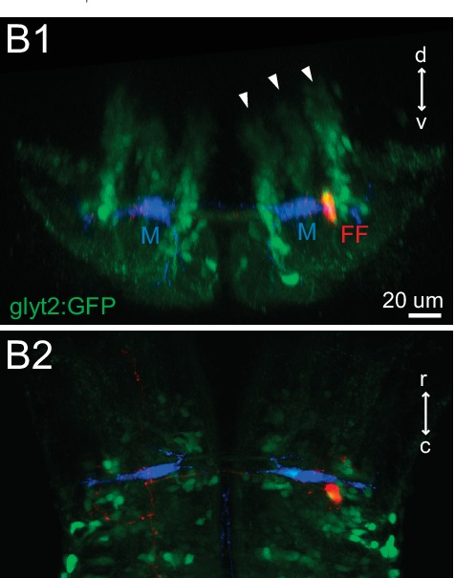
Two Mauthner cells sit side by side in the hindbrain
The Mauthner cells are a single pair of giant neurons, one on each side of the hindbrain, the region of the brainstem that continues into the spinal cord. Each lies in rhombomere 4, one of the repeated segments of the developing hindbrain. Hecker and colleagues describe the Mauthner cell as the largest neuron known in the vertebrate brain.
The M-cells are reticulospinal neurons: their cell bodies lie in the reticular formation of the brainstem, and their axons project down the spinal cord. Each cell has a large lateral dendrite extending toward the ear and a ventral dendrite.
In the larval hindbrain, the two M-cells (blue) lie at the same level, with glycinergic inhibitory neurons (green) packed around them. A feedforward inhibitory neuron (red) lies beside one M-cell. These inhibitory neurons are central to how the pair decides which side fires.
Koyama et al. (2016), Fig. 1B1–B2. Larval hindbrain: Mauthner cells (M, blue), glycinergic neurons (glyt2:GFP, green) and one feedforward neuron (FF, red).
Koyama et al. (2016); Hecker et al. (2020); Watanabe et al. (2017)
10
Notes:
• There are just two Mauthner cells in each fish, one on each side of the hindbrain.
– The hindbrain is the part of the brainstem that joins the spinal cord, and during development it is divided into repeated segments called rhombomeres; the Mauthner cells sit in rhombomere 4.
– Hecker and colleagues describe the Mauthner cell as the largest neuron known in any vertebrate brain.
• They are reticulospinal neurons, meaning their cell bodies are in the brainstem reticular formation and their axons run down the spinal cord.
– Each cell has a long lateral dendrite reaching out toward the ear, and a ventral dendrite.
• In the larval hindbrain the two Mauthner cells, in blue, lie at the same level, surrounded by inhibitory glycinergic neurons in green. The red cell beside one Mauthner cell is a feedforward inhibitory neuron, part of the circuit that decides which Mauthner cell fires.
References:
Koyama M, Minale F, Shum J, Nishimura N, Schaffer CB, Fetcho JR (2016). A circuit motif in the zebrafish hindbrain for a two alternative behavioral choice to turn left or right. eLife 5: e16808. https://doi.org/10.7554/eLife.16808
Hecker A, Schulze W, Oster J, Richter DO, Schuster S (2020). Removing a single neuron in a vertebrate brain forever abolishes an essential behavior. Proceedings of the National Academy of Sciences USA 117(6): 3254–3260. https://doi.org/10.1073/pnas.1918578117
Watanabe T, Shimazaki T, Oda Y (2017). Coordinated expression of two types of low-threshold K+ channels establishes unique single spiking of Mauthner cells among segmentally homologous neurons in the zebrafish hindbrain. eNeuro 4(5): ENEURO.0249-17.2017. https://doi.org/10.1523/ENEURO.0249-17.2017
Figure: Koyama et al. (2016), Fig. 1B1–B2. Larval hindbrain: Mauthner cells (M, blue), glycinergic neurons (glyt2:GFP, green) and one feedforward neuron (FF, red).
Figure source: https://doi.org/10.7554/eLife.16808

Slide 14
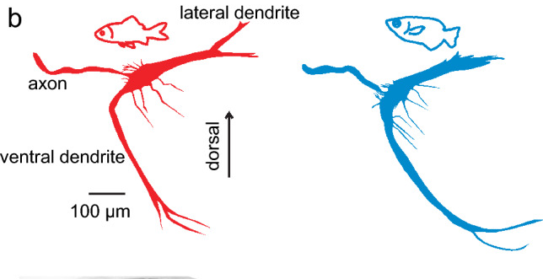
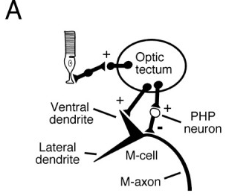
Lateral and ventral dendrites collect different sensory inputs
Intracellular filling of single M-cells in goldfish (red) and archerfish (blue) reveals the same layout: a thick lateral dendrite, a long ventral dendrite, and the axon, which leaves the cell and crosses the midline. Schuster reports no major differences between the two species in this shape.
The two dendrites receive different senses. The lateral dendrite receives auditory and vestibular afferents of the VIIIth cranial nerve from the ipsilateral ear. The ventral dendrite receives visual input from the optic tectum, the main visual center of the fish midbrain.
The tectum also excites inhibitory interneurons, the PHP neurons, that inhibit the M-cell. Visual input therefore reaches the M-cell as excitation on the ventral dendrite and as feedforward inhibition near the cell body. Because both dendrites converge on one cell body and one axon, sound and vision can combine to trigger a single escape command.
Schuster (2023), Fig. 6b. Mauthner neurons filled intracellularly in goldfish (red) and archerfish (blue).
Preuss et al. (2006), Fig. 8A. Visual pathway: the optic tectum excites the ventral dendrite and drives inhibitory PHP neurons.
Schuster (2023); Preuss et al. (2006); Korn & Faber (2005)
11
Notes:
• Filling single Mauthner cells with dye reveals their shape in full.
– In both goldfish and archerfish there is a thick lateral dendrite, a long ventral dendrite, and the axon, which leaves the cell body and crosses to the other side.
– Schuster reports that the cells of the two species are very similar.
• The two dendrites are specialized for different senses.
– The lateral dendrite receives the eighth cranial nerve, which carries hearing and balance signals from the ear on the same side.
– The ventral dendrite receives visual input from the optic tectum, the main visual area of the fish midbrain.
• The tectum also drives inhibitory interneurons called PHP neurons, which inhibit the Mauthner cell.
– Vision therefore both excites and inhibits the cell.
– Both dendrites feed a single cell body and a single axon, so auditory and visual signals end in one decision to fire or not.
References:
Schuster S (2023). The archerfish predictive C-start. Journal of Comparative Physiology A 209(5): 827–837. https://doi.org/10.1007/s00359-023-01658-2
Preuss T, Osei-Bonsu PE, Weiss SA, Wang C, Faber DS (2006). Neural representation of object approach in a decision-making motor circuit. Journal of Neuroscience 26(13): 3454–3464. https://doi.org/10.1523/JNEUROSCI.5259-05.2006
Korn H, Faber DS (2005). The Mauthner cell half a century later: a neurobiological model for decision-making? Neuron 47(1): 13–28. https://doi.org/10.1016/j.neuron.2005.05.019
Figure: Schuster (2023), Fig. 6b. Mauthner neurons filled intracellularly in goldfish (red) and archerfish (blue).
Figure source: https://doi.org/10.1007/s00359-023-01658-2
Figure: Preuss et al. (2006), Fig. 8A. Visual pathway: the optic tectum excites the ventral dendrite and drives inhibitory PHP neurons.
Figure source: https://doi.org/10.1523/JNEUROSCI.5259-05.2006

Slide 15
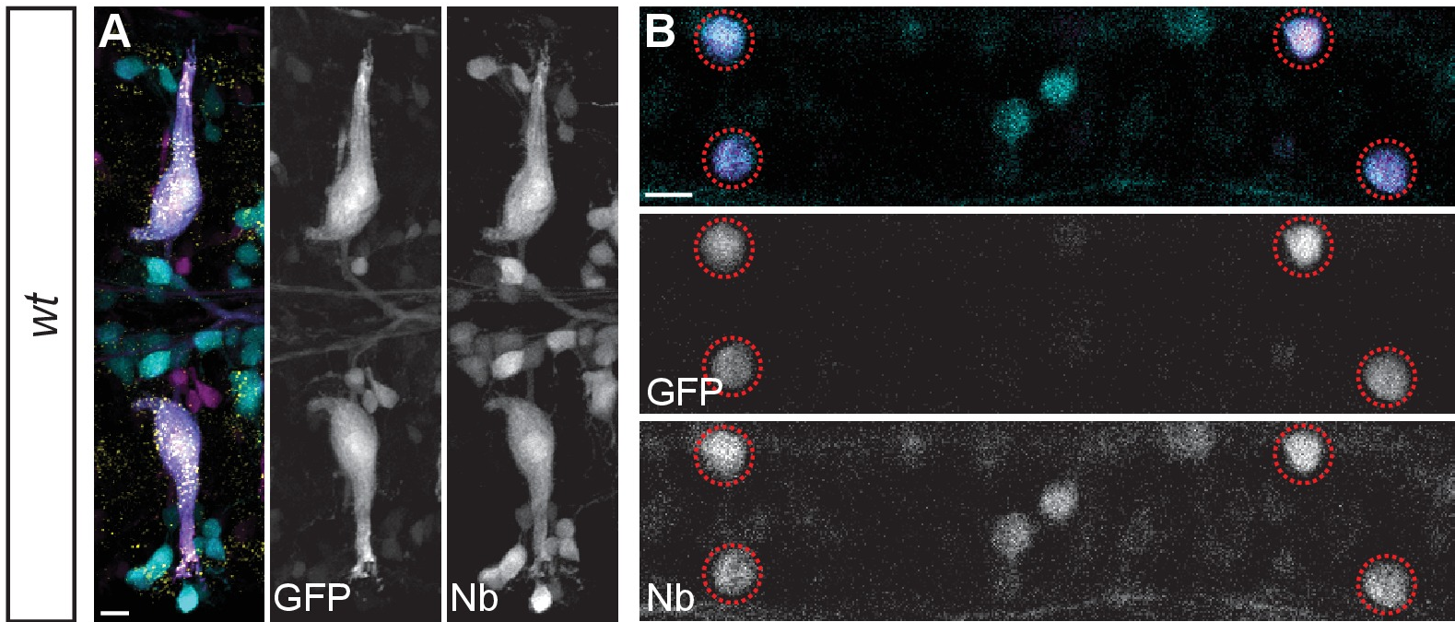
The giant axon crosses the midline and descends the cord
The M-cell axon crosses the midline immediately after leaving the cell body and descends the entire length of the spinal cord on the opposite side. This crossing explains why each M-cell bends the body away from its own side.
Miller and colleagues injected Neurobiotin, a small tracer that passes through gap junctions, into the spinal cord at a caudal cut. The tracer filled the M-cell bodies retrogradely and then crossed into the CoLo interneurons of each spinal segment, which are electrically coupled to the M-axon.
In goldfish, Fetcho and Faber recorded from the M-axon and spinal neurons simultaneously. Each M-axon makes direct chemical excitatory synapses onto primary motoneurons, which innervate fast white muscle, and onto descending excitatory interneurons on its side of the cord. Interneurons that are electrically coupled to the M-axon inhibit the opposite side, which receives input from the other M-axon.
Miller et al. (2017), Fig. 4A–B. Neurobiotin (Nb) backfilled Mauthner cells (A) and dye coupling into spinal CoLo neurons (B, circles).
Miller et al. (2017); Fetcho & Faber (1988)
12
Notes:
• The Mauthner axon crosses to the other side of the brain right away and then runs down the whole spinal cord.
– That crossing is why the left Mauthner cell bends the body to the right, and the right one to the left.
• Miller and colleagues traced the axon with Neurobiotin, a small molecule that can pass through gap junctions.
– Applied to the cut spinal cord, it travels back up the axon and fills the Mauthner cell body.
– It also jumps into the CoLo interneurons along the cord, which tells us those cells are electrically coupled to the Mauthner axon.
• Fetcho and Faber worked out the spinal connections in goldfish by recording from the Mauthner axon and a spinal neuron at the same time.
– The axon directly excites large primary motoneurons, which drive fast white muscle, and descending interneurons that spread the excitation over several segments.
– Coupled interneurons cross the cord and inhibit the other side, so the opposite muscles stay relaxed during the bend.
References:
Miller AC, Whitebirch AC, Shah AN, Marsden KC, Granato M, O'Brien J, Moens CB (2017). A genetic basis for molecular asymmetry at vertebrate electrical synapses. eLife 6: e25364. https://doi.org/10.7554/eLife.25364
Fetcho JR, Faber DS (1988). Identification of motoneurons and interneurons in the spinal network for escapes initiated by the Mauthner cell in goldfish. Journal of Neuroscience 8(11): 4192–4213. https://doi.org/10.1523/JNEUROSCI.08-11-04192.1988
Figure: Miller et al. (2017), Fig. 4A–B. Neurobiotin (Nb) backfilled Mauthner cells (A) and dye coupling into spinal CoLo neurons (B, circles).
Figure source: https://doi.org/10.7554/eLife.25364

Slide 16
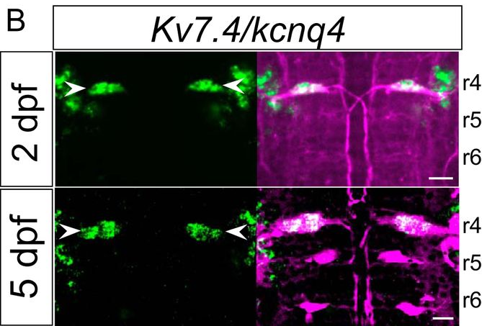
Segmental homologs share inputs but fire differently
The M-cell is the first of a segmental series: morphologically similar reticulospinal neurons repeat in the next hindbrain segments, MiD2cm in rhombomere 5 and MiD3cm in rhombomere 6. All three receive auditory input.
Watanabe and colleagues found that the cells encode that input differently. When excited, the M-cell fires a single spike at the onset of an abrupt stimulus, whereas MiD2cm and MiD3cm fire repeatedly, encoding stimulus intensity in their firing frequency.
In situ hybridization, which labels the cells expressing a given mRNA, detected the potassium channel gene Kv7.4/kcnq4 in the M-cells (arrowheads, green) at 2 and 5 days after fertilization, but not in MiD2cm or MiD3cm. The homologs contribute to behavior in their own right: with MiD2cm and MiD3cm intact, larvae lacking only the M-cell still escape quickly from head-directed stimuli, and MiD3cm is strongly active during escapes that the M-cell does not trigger.
Watanabe et al. (2017), Fig. 3B. Kv7.4 mRNA (green) in M-cells (arrowheads) of rhombomere 4 at 2 and 5 dpf; reticulospinal neurons labeled in magenta.
Watanabe et al. (2017); Liu & Fetcho (1999); Kohashi & Oda (2008)
13
Notes:
• The Mauthner cell has relatives in the next two hindbrain segments.
– MiD2cm sits in rhombomere 5 and MiD3cm in rhombomere 6; they look like smaller versions of the Mauthner cell and they also receive auditory input.
• What separates them is how they fire.
– The Mauthner cell gives one spike at the start of an abrupt stimulus, while the homologs fire trains of spikes whose rate grows with stimulus strength.
• Watanabe and colleagues looked for a molecular difference.
– In situ hybridization labels cells that make a particular messenger RNA, and the Kv7.4 potassium channel message was found in the Mauthner cells but not in the homologs, both at two and five days after fertilization.
• The homologs matter for behavior. Liu and Fetcho's ablations implicated them in fast escapes from the head, and Kohashi and Oda saw MiD3cm strongly active during escapes in which the Mauthner cell stayed silent.
References:
Watanabe T, Shimazaki T, Oda Y (2017). Coordinated expression of two types of low-threshold K+ channels establishes unique single spiking of Mauthner cells among segmentally homologous neurons in the zebrafish hindbrain. eNeuro 4(5): ENEURO.0249-17.2017. https://doi.org/10.1523/ENEURO.0249-17.2017
Liu KS, Fetcho JR (1999). Laser ablations reveal functional relationships of segmental hindbrain neurons in zebrafish. Neuron 23(2): 325–335. https://doi.org/10.1016/S0896-6273(00)80783-7
Kohashi T, Oda Y (2008). Initiation of Mauthner- or non-Mauthner-mediated fast escape evoked by different modes of sensory input. Journal of Neuroscience 28(42): 10641–10653. https://doi.org/10.1523/JNEUROSCI.1435-08.2008
Figure: Watanabe et al. (2017), Fig. 3B. Kv7.4 mRNA (green) in M-cells (arrowheads) of rhombomere 4 at 2 and 5 dpf; reticulospinal neurons labeled in magenta.
Figure source: https://doi.org/10.1523/ENEURO.0249-17.2017

Slide 17
Serial homologs share an origin but not a firing code
Serial homologs are cells built by the same developmental program repeated in successive body segments. The hindbrain develops as a chain of rhombomeres, and Watanabe and colleagues propose that the M-cell, MiD2cm and MiD3cm arose from one ancestral neuron duplicated segment by segment and then modified. Their similar shape and common auditory input reflect that shared origin.
Shared ancestry leaves room for different jobs. The three cells receive the same afferent signal but extract different features from it: the M-cell marks the onset of an abrupt sound, while its homologs encode its strength in firing rate. Watanabe and colleagues trace the split to the potassium channels each cell expresses, so a few genes convert one template into an onset detector or an intensity coder.
The division of labor limits substitution. With the M-cell gone, the homologs still support fast escapes from head-directed stimuli, yet after the M-axon was removed, fish never regained fast escapes toward that side, even though Hecker's test stimulus also activated the homologs.
Watanabe et al. (2017), Fig. 3B. Kv7.4 mRNA (green) in M-cells (arrowheads) of rhombomere 4 at 2 and 5 dpf; reticulospinal neurons labeled in magenta.
Watanabe et al. (2017); Liu & Fetcho (1999); Hecker et al. (2020)
13a
Notes:
• Slide 13 introduces three similar cells in neighboring segments; the useful distinction is between where the cells came from and what each now does.
• Segmentation builds repeated cell types.
– Slide 10 places the M-cell in rhombomere 4; the same developmental program in rhombomeres 5 and 6 produces cells of similar form.
– Watanabe and colleagues frame the M-series as an evolutionary duplication followed by divergence, which is a hypothesis about ancestry rather than a statement about function.
• Function diverged through ion channels.
– On slides 30 to 32, the M-cell's single spike depends on Kv1 and Kv7 currents, and that blocking both makes it fire like its homologs.
– In the authors' framing, the M-cell encodes when a sound begins and the homologs encode how loud it is.
• Homology does not guarantee backup.
– Liu and Fetcho found that killing the M-cell alone spared fast escapes from the head but not from the tail, so the homologs cover only part of the M-cell's range.
– Hecker and colleagues chose a stimulus that demonstrably activated the homologs, and the escapes that needed the missing M-axon stayed slow even five months later, as slide 35 shows.
References:
Watanabe T, Shimazaki T, Oda Y (2017). Coordinated expression of two types of low-threshold K+ channels establishes unique single spiking of Mauthner cells among segmentally homologous neurons in the zebrafish hindbrain. eNeuro 4(5): ENEURO.0249-17.2017. https://doi.org/10.1523/ENEURO.0249-17.2017
Liu KS, Fetcho JR (1999). Laser ablations reveal functional relationships of segmental hindbrain neurons in zebrafish. Neuron 23(2): 325–335. https://doi.org/10.1016/S0896-6273(00)80783-7
Hecker A, Schulze W, Oster J, Richter DO, Schuster S (2020). Removing a single neuron in a vertebrate brain forever abolishes an essential behavior. Proceedings of the National Academy of Sciences USA 117(6): 3254–3260. https://doi.org/10.1073/pnas.1918578117

Slide 18
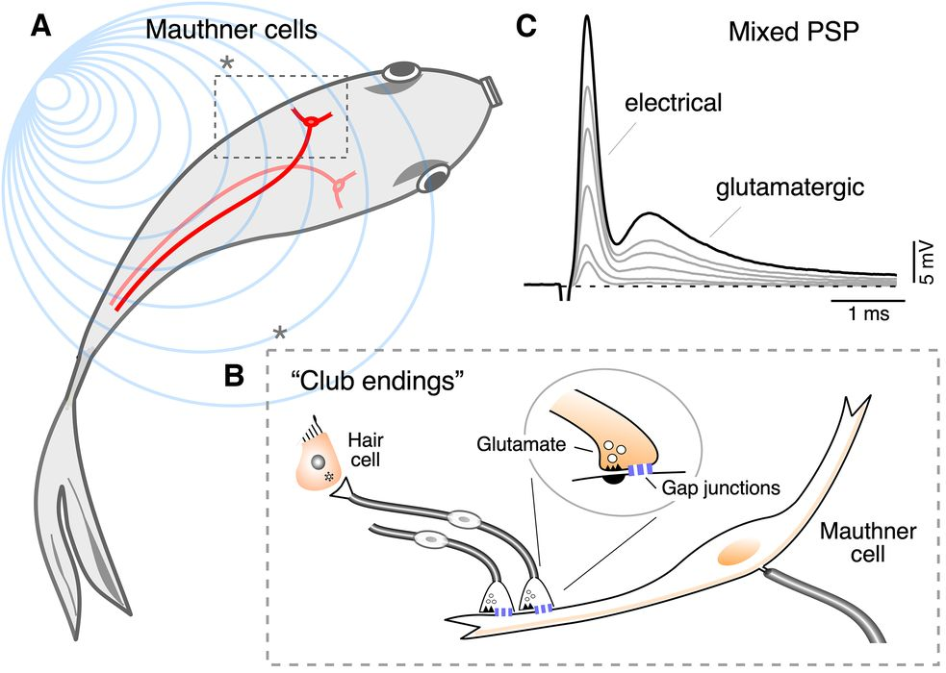
Club endings are mixed electrical–chemical synapses
Auditory afferents from the fish sacculus, the main auditory organ, each end as a single large terminal on the distal lateral dendrite of the M-cell. These large myelinated club endings contain both gap junctions, channels that connect the cytoplasm of two cells, and glutamate release sites. They are mixed synapses.
Stimulating the auditory nerve produces a mixed postsynaptic potential with an early electrical component followed by a delayed glutamatergic component, and both grow as more afferents are recruited. Electron microscopy of a 6-day-old zebrafish identifies a club ending in direct contact with the M-cell lateral dendrite.
Furshpan identified the electrical component in goldfish. The EPSP appeared about 0.1 ms after eighth-nerve stimulation, a negligible synaptic delay, and was largest in the distal lateral dendrite where club endings cluster. Potential changes in the M-cell also spread backward into the afferent fibers, the signature of low-resistance connections.
Echeverry et al. (2022), Fig. 1A–C. M-cells in the fish, club endings on the lateral dendrite, and the mixed PSP with electrical and glutamatergic components.
Echeverry et al. (2022); Furshpan (1964)
14
Notes:
• The main auditory input to the Mauthner cell arrives through club endings.
– Each auditory afferent from the sacculus, the main hearing organ of fish, ends in one large terminal on the far end of the lateral dendrite.
– Each terminal has gap junctions, which are channels that directly connect the inside of one cell to the inside of the other, and it also releases glutamate.
• A single stimulus therefore produces two responses in the Mauthner cell.
– First comes a fast electrical component, current flowing directly through the gap junctions.
– Then comes a slower glutamatergic component, produced by transmitter release and receptor activation.
• Furshpan's 1964 recordings were the first evidence for electrical transmission at a synapse in a vertebrate brain.
– The early potential appeared about a tenth of a millisecond after nerve stimulation, essentially no synaptic delay.
– Voltage changes in the Mauthner cell also spread backward into the afferent fibers, which only happens if the two cells are joined by low-resistance connections.
References:
Echeverry FA, Ijaz S, Pereda AE (2022). Recording synaptic transmission from auditory mixed synapses on the Mauthner cells of developing zebrafish. eNeuro 9(3): ENEURO.0021-22.2022. https://doi.org/10.1523/ENEURO.0021-22.2022
Furshpan EJ (1964). "Electrical transmission" at an excitatory synapse in a vertebrate brain. Science 144(3620): 878–880. https://doi.org/10.1126/science.144.3620.878
Figure: Echeverry et al. (2022), Fig. 1A–C. M-cells in the fish, club endings on the lateral dendrite, and the mixed PSP with electrical and glutamatergic components.
Figure source: https://doi.org/10.1523/ENEURO.0021-22.2022

Slide 19
Electrical and chemical halves differ in speed and duration
At an electrical synapse, current passes directly from one cytoplasm into the other through gap junction channels, so the target's voltage starts to change as the presynaptic spike arrives. At a chemical synapse, the spike must first open calcium channels and trigger vesicle fusion, and glutamate must cross the cleft and open receptors, a sequence that adds delay.
The two components can be told apart in a recording because the M-cell has an unusually fast membrane time constant, the time its voltage takes to rise or decay after a current step. A brief electrical current therefore produces a brief potential that is largely over before the glutamate response peaks.
Each half has its own role. The electrical component supplies the earliest possible depolarization, and losing it delayed startles by about 2 ms. In goldfish, a sound also evokes a slower glutamatergic depolarizing envelope, which Otero-Coronel and colleagues describe as carrying mostly information about stimulus intensity.
Echeverry et al. (2022), Fig. 1A–C. M-cells in the fish, club endings on the lateral dendrite, and the mixed PSP with electrical and glutamatergic components.
Echeverry et al. (2022); Lasseigne et al. (2021); Otero-Coronel et al. (2024)
14a
Notes:
• Slide 14 introduces the mixed synapse; the reason one terminal carries two kinds of transmission becomes clear once the timing of each is spelled out.
• Electrical and chemical transmission differ in how many steps they need.
– Current through a gap junction needs no intermediate step, so the delay is essentially zero, which is what Furshpan measured.
– Chemical transmission requires calcium entry, vesicle release, diffusion and receptor gating, each adding time, so the glutamatergic component on slide 17 arrives later and lasts longer.
• The M-cell's membrane makes the separation visible.
– Echeverry and colleagues point out that the two components are easy to distinguish because the M-cell's time constant is so short, an observation going back to Fukami and colleagues.
– A slow membrane would smear the brief electrical potential into the chemical one.
• The two halves contribute differently to behavior.
– When the gap junctions were removed in ZO1b mutants on slide 21, startles still occurred but began about two milliseconds late, so the electrical half sets timing.
– The glutamatergic half facilitates during high-frequency bursts on slide 17 and, in goldfish recordings, forms a slow envelope that tracks how strong the sound is.
References:
Echeverry FA, Ijaz S, Pereda AE (2022). Recording synaptic transmission from auditory mixed synapses on the Mauthner cells of developing zebrafish. eNeuro 9(3): ENEURO.0021-22.2022. https://doi.org/10.1523/ENEURO.0021-22.2022
Lasseigne AM, Echeverry FA, Ijaz S, Michel JC, Martin EA, Marsh AJ, Trujillo E, Marsden KC, Pereda AE, Miller AC (2021). Electrical synaptic transmission requires a postsynaptic scaffolding protein. eLife 10: e66898. https://doi.org/10.7554/eLife.66898
Otero-Coronel S, Preuss T, Medan V (2024). Multisensory integration enhances audiovisual responses in the Mauthner cell. eLife 13: RP99424. https://doi.org/10.7554/eLife.99424
Fukami Y, Furukawa T, Asada Y (1965). Excitability changes of the Mauthner cell during collateral inhibition. Journal of General Physiology 48(4): 581–600. https://doi.org/10.1085/jgp.48.4.581

Slide 20
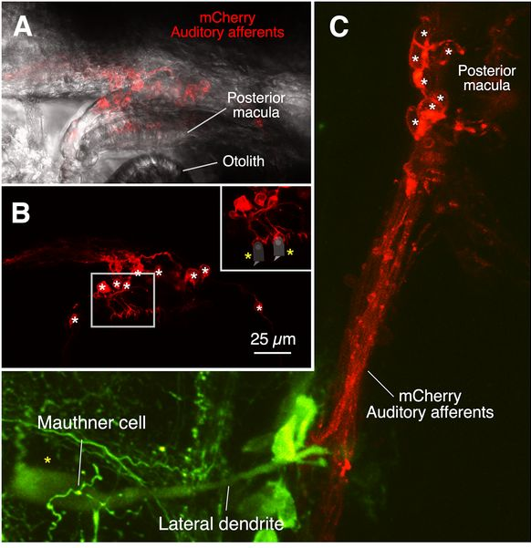
Larval club endings arise from the posterior macula
In adult goldfish, the auditory afferents that form club endings contact hair cells of the saccular macula. Echeverry and colleagues traced their origin in 5-day-old zebrafish larvae, whose ear is still developing.
A Gal4 line expressing the red protein mCherry labeled auditory afferents. Their dendrites formed cup-shaped terminals on hair cells of the posterior macula, the sensory patch under the posterior otolith (an ear stone that moves relative to the hair cells). The posterior macula develops into the adult sacculus.
The labeled afferents run from the posterior macula to the M-cell lateral dendrite, where they end as club endings (green: M-cell). Stimulating the posterior macula with an electrode evoked the same mixed electrical and chemical response in the M-cell. Larval and adult club endings therefore originate in the same auditory end organ at different developmental stages.
Echeverry et al. (2022), Fig. 4A–C. mCherry-labeled auditory afferents (red) contact posterior-macula hair cells and project to the M-cell lateral dendrite (green).
Echeverry et al. (2022)
15
Notes:
• In adult fish, the club-ending afferents start at hair cells of the sacculus.
– Echeverry and colleagues asked where they start in larvae, whose ears are still developing.
• They used a genetic line in which auditory afferents make a red fluorescent protein.
– The afferents wrapped cup-shaped endings around hair cells of the posterior macula, the patch of hair cells beneath the posterior otolith.
– Otoliths are small mineral stones that move relative to the hair cells and bend their hair bundles; the posterior macula later becomes the adult sacculus.
• Following the red fibers inward, they end on the lateral dendrite of the Mauthner cell, which is green.
– Electrical stimulation of the posterior macula evoked the same two-part response, electrical then chemical, in the Mauthner cell.
– Larval and adult club endings therefore come from the same auditory organ at two stages of development.
References:
Echeverry FA, Ijaz S, Pereda AE (2022). Recording synaptic transmission from auditory mixed synapses on the Mauthner cells of developing zebrafish. eNeuro 9(3): ENEURO.0021-22.2022. https://doi.org/10.1523/ENEURO.0021-22.2022
Figure: Echeverry et al. (2022), Fig. 4A–C. mCherry-labeled auditory afferents (red) contact posterior-macula hair cells and project to the M-cell lateral dendrite (green).
Figure source: https://doi.org/10.1523/ENEURO.0021-22.2022

Slide 21
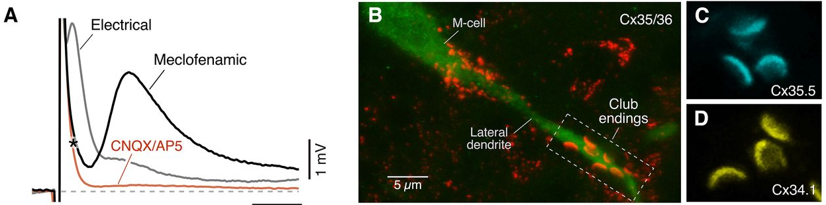
The early component passes through gap junctions
Echeverry and colleagues recorded club-ending responses from larval M-cells by whole-cell patch clamp. Meclofenamic acid, a gap junction blocker, abolished the early component and left the delayed one, which the glutamate receptor blockers CNQX and DAP5 then removed.
Immunolabeling located the junctions. An antibody to the connexin family Cx35/36 stained the club-ending contacts on the lateral dendrite, and antibodies against two zebrafish connexins, Cx35.5 (cyan) and Cx34.1 (yellow), each labeled the same crescent-shaped contacts. Connexins are the proteins that assemble into gap junction channels.
In larvae lacking either Cx34.1 (gjd1a mutants) or Cx35.5 (gjd2a mutants), the electrical component was absent, and the remaining response was entirely glutamatergic. The fast potential that Furshpan recorded therefore depends on two connexins at each contact.
Echeverry et al. (2022), Fig. 6A–D. Meclofenamic acid removes the electrical component (A); Cx35/36, Cx35.5 and Cx34.1 at club endings (B–D).
Echeverry et al. (2022); Furshpan (1964)
16
Notes:
• Two blockers separated the two parts of the club-ending response.
– Meclofenamic acid blocks gap junctions, and when it was applied the early, electrical part of the response disappeared while the later part stayed.
– CNQX and DAP5, which block glutamate receptors, then abolished what was left.
• Antibody staining showed where the gap junctions are.
– Connexins are the proteins that make gap junction channels, and staining for the Cx35/36 family lit up the club-ending contacts on the lateral dendrite.
– Two zebrafish connexins, Cx35.5 and Cx34.1, were both present at the same crescent-shaped contacts.
• Genetics confirmed the requirement. Mutant larvae lacking either connexin had no electrical component at all, and their club-ending response was purely chemical.
References:
Echeverry FA, Ijaz S, Pereda AE (2022). Recording synaptic transmission from auditory mixed synapses on the Mauthner cells of developing zebrafish. eNeuro 9(3): ENEURO.0021-22.2022. https://doi.org/10.1523/ENEURO.0021-22.2022
Furshpan EJ (1964). "Electrical transmission" at an excitatory synapse in a vertebrate brain. Science 144(3620): 878–880. https://doi.org/10.1126/science.144.3620.878
Figure: Echeverry et al. (2022), Fig. 6A–D. Meclofenamic acid removes the electrical component (A); Cx35/36, Cx35.5 and Cx34.1 at club endings (B–D).
Figure source: https://doi.org/10.1523/ENEURO.0021-22.2022

Slide 22
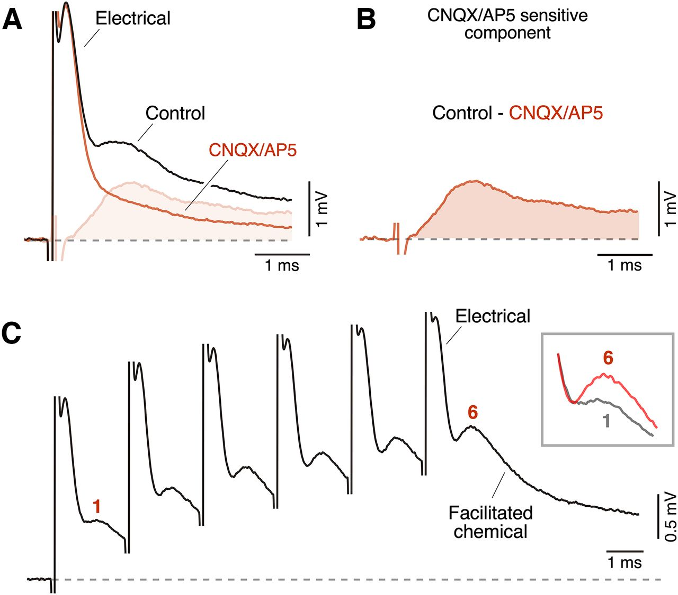
The delayed component is glutamatergic and facilitates
Applying the glutamate receptor antagonists CNQX (which blocks AMPA-type receptors) and DAP5 (which blocks NMDA receptors) suppressed the delayed, longer-lasting component of the club-ending response without affecting the early electrical component. Subtracting the trace recorded in the drugs from the control trace isolates the time course of the glutamatergic component.
The chemical component lasts several milliseconds, much longer than the electrical spike, and large dendritic potentials in the M-cell return to baseline slowly.
Repeated stimulation changes the chemical component. In a train of six pulses 2 ms apart (500 Hz), the chemical component grew from the first to the last pulse. This facilitation, an increase in response with repeated stimulation, means that a brief burst of auditory activity can build up the glutamatergic drive to the M-cell.
Echeverry et al. (2022), Fig. 5A–C. CNQX/AP5 isolates the glutamatergic component (A–B); a 500 Hz train facilitates the chemical component (C).
Echeverry et al. (2022)
17
Notes:
• The second part of the club-ending response is chemical, carried by glutamate.
– CNQX blocks AMPA-type glutamate receptors and DAP5 blocks NMDA-type receptors, and together they removed the slow component while the fast electrical one stayed.
– Subtracting the trace recorded in the blockers from the control trace isolates the glutamate-driven part.
• That chemical component lasts several milliseconds, much longer than the electrical one.
• High-frequency stimulation changes the chemical component.
– When six pulses were delivered two milliseconds apart, the chemical component got bigger from the first pulse to the last.
– That growth is facilitation, so a burst of auditory spikes increases the glutamate drive onto the Mauthner cell.
References:
Echeverry FA, Ijaz S, Pereda AE (2022). Recording synaptic transmission from auditory mixed synapses on the Mauthner cells of developing zebrafish. eNeuro 9(3): ENEURO.0021-22.2022. https://doi.org/10.1523/ENEURO.0021-22.2022
Figure: Echeverry et al. (2022), Fig. 5A–C. CNQX/AP5 isolates the glutamatergic component (A–B); a 500 Hz train facilitates the chemical component (C).
Figure source: https://doi.org/10.1523/ENEURO.0021-22.2022

Slide 23
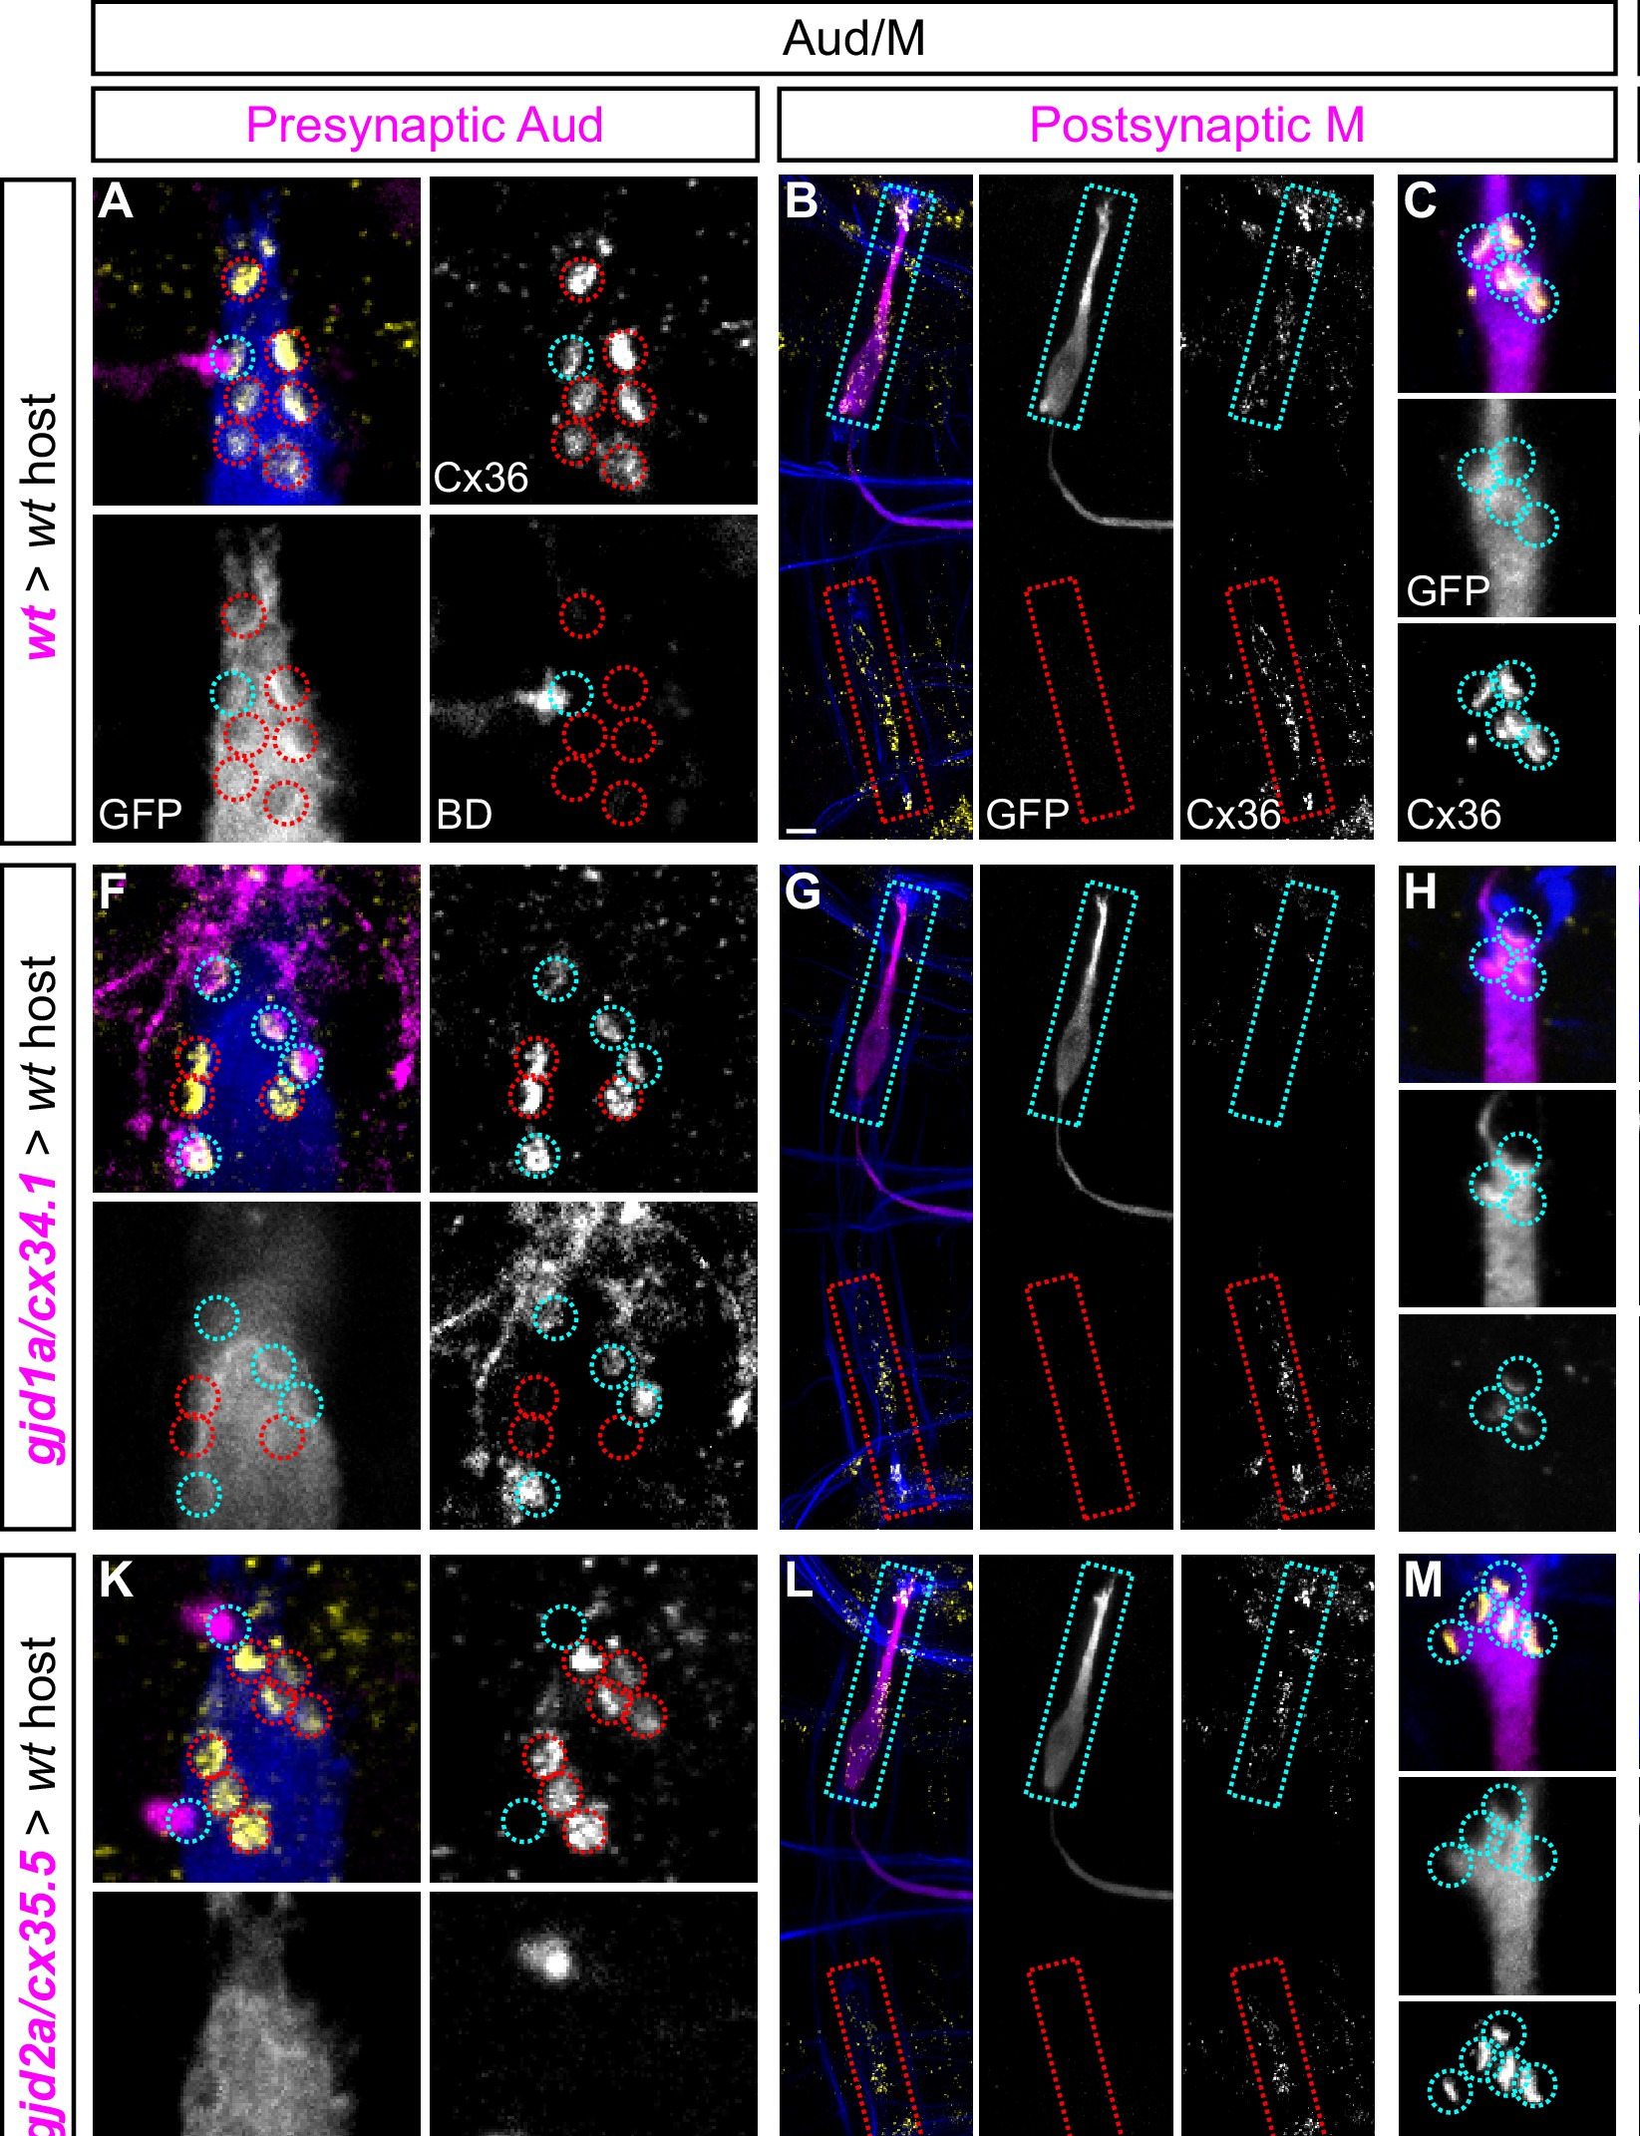
Two different connexins build each club-ending gap junction
Gap junctions are often pictured as symmetric: the same connexin on both sides. Miller and colleagues tested this at Mauthner synapses using chimeric larvae, made by transplanting cells from a donor embryo of one genotype into a host of another, so that the cells on either side of a synapse could carry different mutations.
When a transplanted auditory afferent lacked Cx35.5 (gjd2a), connexin staining at its club endings on a normal M-cell was lost; an afferent lacking Cx34.1 (gjd1a) formed normal junctions. When the transplanted M-cell lacked Cx34.1, staining at its club endings was greatly reduced, whereas an M-cell lacking Cx35.5 was normal.
Cx35.5 is required presynaptically and Cx34.1 postsynaptically. The same asymmetric rule held at the M-axon to CoLo synapses in the spinal cord. Electrical synapses in this circuit are therefore molecularly asymmetric, built from a different connexin in each partner.
Miller et al. (2017), Fig. 6A–M. Chimeras: donor auditory afferents (A, F, K) or M-cells (B–C, G–H, L–M) of wild-type, gjd1a or gjd2a genotype; Cx36 at club endings.
Miller et al. (2017)
18
Notes:
• It is often assumed that a gap junction is symmetrical, with the same connexin protein contributed by each of the two cells.
– Miller and colleagues tested this with chimeric larvae, built by transplanting cells from one embryo into another so that the two partners of a synapse can have different genotypes.
• The results depended on which side carried the mutation.
– If the auditory afferent lacked Cx35.5, the club-ending gap junction was lost, but if it lacked Cx34.1 the junction formed normally.
– If the Mauthner cell lacked Cx34.1 the junction staining was greatly reduced, but lacking Cx35.5 made no difference.
• Cx35.5 therefore works on the presynaptic side and Cx34.1 on the postsynaptic side. The same rule applied where the Mauthner axon contacts CoLo neurons in the spinal cord, so these electrical synapses are built from two different halves.
References:
Miller AC, Whitebirch AC, Shah AN, Marsden KC, Granato M, O'Brien J, Moens CB (2017). A genetic basis for molecular asymmetry at vertebrate electrical synapses. eLife 6: e25364. https://doi.org/10.7554/eLife.25364
Figure: Miller et al. (2017), Fig. 6A–M. Chimeras: donor auditory afferents (A, F, K) or M-cells (B–C, G–H, L–M) of wild-type, gjd1a or gjd2a genotype; Cx36 at club endings.
Figure source: https://doi.org/10.7554/eLife.25364

Slide 24
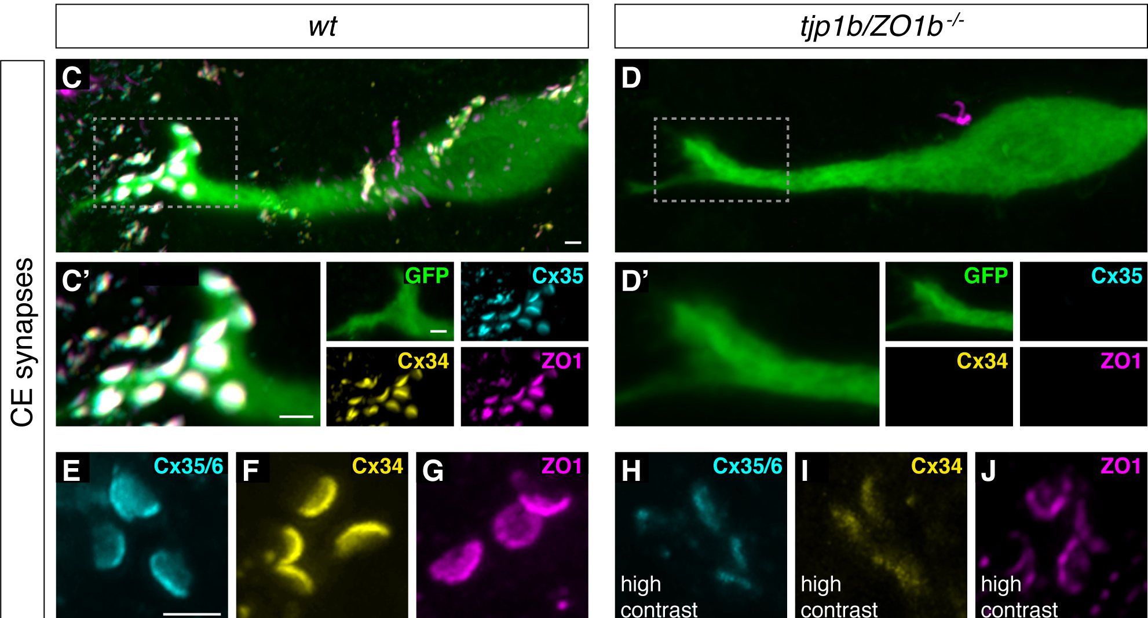
ZO1b anchors connexins at the postsynaptic side
Chemical synapses depend on scaffolding proteins that hold receptors in place. Lasseigne and colleagues asked whether gap junctions need one. ZO1 (zonula occludens 1) is an intracellular scaffold found at electrical synapses.
In wild-type larvae, Cx35.5 (cyan), Cx34.1 (yellow) and ZO1 (magenta) colocalized at club endings on the M-cell lateral dendrite (green). In tjp1b/ZO1b mutants both connexins were lost from the contacts, whereas in connexin mutants ZO1b still localized normally. ZO1b is upstream: it is required for connexins to accumulate, but not the reverse.
Biochemical experiments placed the interaction precisely. The first PDZ domain of ZO1b, a protein-binding module, bound the C-terminal motif of both connexins, but in the brain ZO1b associated with Cx34.1. In chimeric larvae ZO1b was found only on the postsynaptic side, matching the postsynaptic role of Cx34.1.
Lasseigne et al. (2021), Fig. 1C–J. Club endings in wild-type and tjp1b/ZO1b mutant larvae: GFP (M-cell), Cx35, Cx34 and ZO1.
Lasseigne et al. (2021); Miller et al. (2017)
19
Notes:
• At chemical synapses, receptors are held in place by scaffolding proteins, and Lasseigne and colleagues asked whether electrical synapses work the same way.
– ZO1 is a scaffolding protein known to sit at electrical synapses.
• In normal larvae, both connexins and ZO1 are found together at the club endings.
– In larvae lacking ZO1b, both connexins vanished from those contacts.
– In larvae lacking a connexin, ZO1b was still there, so the dependence runs in one direction: ZO1b is needed to place the connexins.
• The binding was traced to a specific part of the protein.
– ZO1b's first PDZ domain, a module that binds short motifs at the ends of other proteins, grabbed the tail of each connexin.
– In the fish brain ZO1b associated with Cx34.1, and chimera experiments put ZO1b only on the postsynaptic side, the same side as Cx34.1.
References:
Lasseigne AM, Echeverry FA, Ijaz S, Michel JC, Martin EA, Marsh AJ, Trujillo E, Marsden KC, Pereda AE, Miller AC (2021). Electrical synaptic transmission requires a postsynaptic scaffolding protein. eLife 10: e66898. https://doi.org/10.7554/eLife.66898
Miller AC, Whitebirch AC, Shah AN, Marsden KC, Granato M, O'Brien J, Moens CB (2017). A genetic basis for molecular asymmetry at vertebrate electrical synapses. eLife 6: e25364. https://doi.org/10.7554/eLife.25364
Figure: Lasseigne et al. (2021), Fig. 1C–J. Club endings in wild-type and tjp1b/ZO1b mutant larvae: GFP (M-cell), Cx35, Cx34 and ZO1.
Figure source: https://doi.org/10.7554/eLife.66898

Slide 25
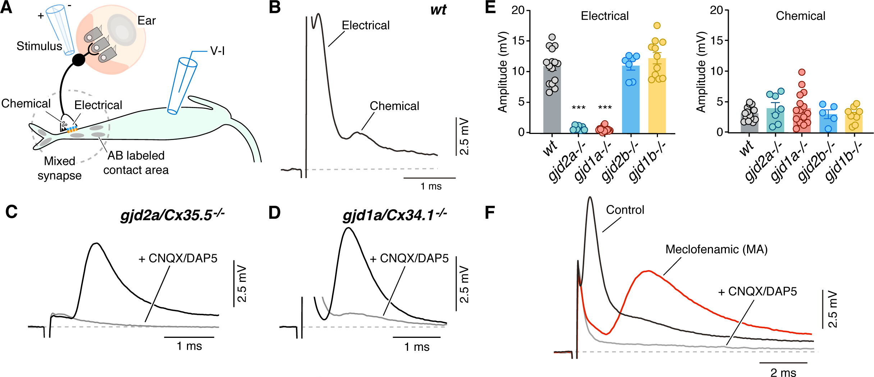
Without ZO1b the electrical component disappears
Lasseigne and colleagues stimulated the auditory afferents and recorded the M-cell by whole-cell patch clamp. In wild-type larvae the club-ending response had the usual early electrical and delayed chemical components.
Larvae lacking Cx35.5 or Cx34.1 had no detectable electrical component; the remaining response was blocked by CNQX and DAP5. tjp1b/ZO1b mutants had the same phenotype: the electrical component was abolished while the chemical component was preserved. Larvae lacking the related ZO1a had normal responses.
Glutamate receptor (GluR2/3) staining at the club endings was unaffected in the mutants, so the chemical half of each mixed synapse forms independently of the electrical half. Without electrical input, M-cells in ZO1b mutants also showed increased excitability, so the loss of gap junctions changes how readily the cell fires as well as how quickly it is driven.
Lasseigne et al. (2021), Fig. 3A–I. Club-ending responses in wild type and in connexin and ZO1 mutants; electrical and chemical amplitudes (E, I).
Lasseigne et al. (2021)
20
Notes:
• The recordings tested whether ZO1b matters for function, not just for where connexins sit.
– In normal larvae, stimulating auditory afferents gives the familiar fast electrical response followed by the slower chemical response.
• In larvae lacking either connexin, and in larvae lacking ZO1b, the electrical component was gone.
– The chemical component was still there, and blocking glutamate receptors removed it.
– Larvae lacking the related protein ZO1a responded normally, so the requirement is specific to ZO1b.
• Glutamate receptors were still present at the club endings in the mutants, so the chemical half of each mixed synapse does not depend on the electrical half.
– The Mauthner cells of the mutants were also more excitable, so losing the gap junctions changed the cell's sensitivity as well.
References:
Lasseigne AM, Echeverry FA, Ijaz S, Michel JC, Martin EA, Marsh AJ, Trujillo E, Marsden KC, Pereda AE, Miller AC (2021). Electrical synaptic transmission requires a postsynaptic scaffolding protein. eLife 10: e66898. https://doi.org/10.7554/eLife.66898
Figure: Lasseigne et al. (2021), Fig. 3A–I. Club-ending responses in wild type and in connexin and ZO1 mutants; electrical and chemical amplitudes (E, I).
Figure source: https://doi.org/10.7554/eLife.66898

Slide 26
Gap junctions leak current, so losing them raises excitability
Input resistance sets how far a given current moves a neuron's voltage; the more open routes current has to leave the cell, the lower it is. Each club-ending gap junction is such a route into a coupled afferent, so together the junctions act as a leak.
Lasseigne and colleagues measured the consequence. In ZO1b and connexin mutants, M-cell input resistance rose sharply and the rheobase, the smallest current step that fires the cell, fell. Small spontaneous glutamatergic events also became easier to detect, as the same synaptic current now produced a larger voltage.
Input resistance is a general control point for the startle. Cortisol also raises M-cell input resistance near threshold and lowers the current needed to fire it, while the voltage threshold stays the same. Missing gap junctions and a stress hormone thus make the cell easier to fire by one route.
Lasseigne et al. (2021), Fig. 3A–I. Club-ending responses in wild type and in connexin and ZO1 mutants; electrical and chemical amplitudes (E, I).
Lasseigne et al. (2021); Bronson & Preuss (2017)
20a
Notes:
• Slide 20 ends with the observation that M-cells lacking gap junctions are more excitable; that result follows from basic membrane electricity.
• Resistance sets how far a current moves the voltage.
– By Ohm's relation, a given synaptic or injected current produces a bigger voltage change across a membrane that offers fewer escape routes.
– Gap junctions are open channels to another cell, so they add escape routes, and on slide 14 voltage in the M-cell was seen spreading backward into the afferents through them.
• The mutants confirmed the prediction.
– Lasseigne and colleagues measured input resistance, rheobase, resting potential and spike threshold in whole-cell recordings, and the change in input resistance tracked the loss of electrical transmission.
– They proposed that the higher input resistance also explains why more spontaneous chemical events were detected in the mutants, although release itself was unchanged.
• Cortisol, on slide 44, reaches the same variable from a different direction.
– Bronson and Preuss injected current ramps and found a lower threshold current after cortisol, while the absolute voltage threshold did not change.
– Distinguishing current threshold from voltage threshold matters: a cell can become easier to fire because a given input moves it further, not because the spike-generating mechanism changed.
References:
Lasseigne AM, Echeverry FA, Ijaz S, Michel JC, Martin EA, Marsh AJ, Trujillo E, Marsden KC, Pereda AE, Miller AC (2021). Electrical synaptic transmission requires a postsynaptic scaffolding protein. eLife 10: e66898. https://doi.org/10.7554/eLife.66898
Bronson DR, Preuss T (2017). Cellular mechanisms of cortisol-induced changes in Mauthner-cell excitability in the startle circuit of goldfish. Frontiers in Neural Circuits 11: 68. https://doi.org/10.3389/fncir.2017.00068

Slide 27
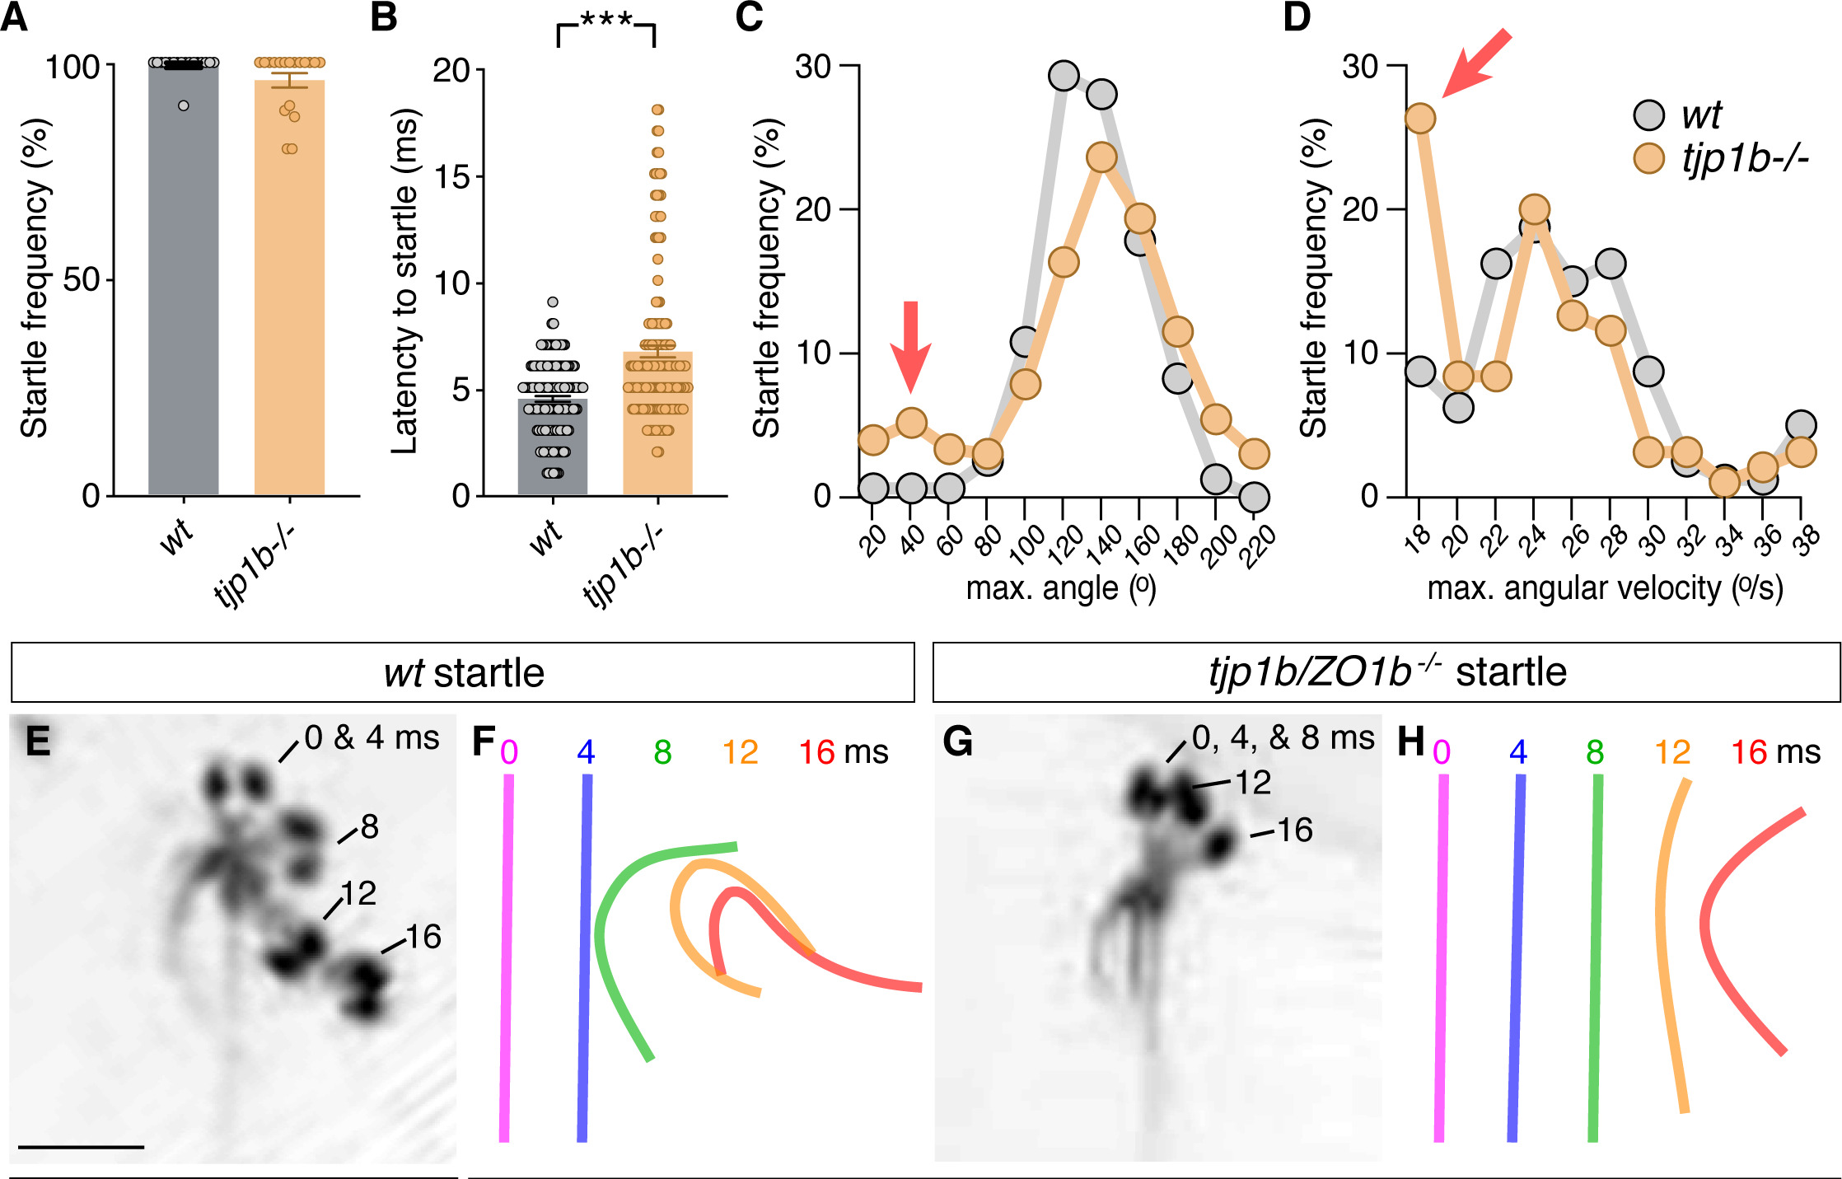
Electrical synapses make the startle fast and coordinated
ZO1b mutants startled to strong acoustic stimuli as often as their wild-type siblings, but they began their startles about 2 ms later. This delay matches the electrophysiology: without electrical transmission the escape network operates with longer synaptic delays.
Most mutant startles had normal turn angles and velocities, but about 15% were abnormally shallow and slow. Overlaying body midlines every 4 ms, wild-type larvae curled into a deep C within 16 ms, while some mutant larvae formed kinked or S-shaped postures. Miller and colleagues had found the same defects in connexin mutants, and they resemble startles after ablation of the spinal CoLo neurons.
Mutants were also more likely to startle at mid-range intensities, and their long-latency C-bends nearly disappeared. Electrical synapses therefore contribute speed, coordination and the innate threshold of the Mauthner startle.
Lasseigne et al. (2021), Fig. 5A–H. Startle frequency, latency and kinematics; overlaid wild-type and tjp1b/ZO1b mutant startles at 0–16 ms.
Lasseigne et al. (2021); Miller et al. (2017); Satou et al. (2009)
21
Notes:
• The behavioral consequences of losing the electrical synapses were subtle but clear.
– ZO1b mutants startled as often as normal larvae to strong sounds, but each startle began about two milliseconds later, matching the slower synaptic drive in the recordings.
• The shape of the startle also suffered.
– About 15 percent of mutant startles were shallow, slow bends, and frame-by-frame tracings showed kinked or S-shaped bodies instead of a clean C.
– The same defects occur in connexin mutants, and they look like startles after CoLo neurons in the spinal cord are destroyed, which points to the electrical synapses between the Mauthner axon and CoLo.
• Threshold changed too.
– Mutants startled more readily to medium-strength sounds, and long-latency C-bends almost vanished, so the electrical synapses also help set how easily the Mauthner cell fires.
References:
Lasseigne AM, Echeverry FA, Ijaz S, Michel JC, Martin EA, Marsh AJ, Trujillo E, Marsden KC, Pereda AE, Miller AC (2021). Electrical synaptic transmission requires a postsynaptic scaffolding protein. eLife 10: e66898. https://doi.org/10.7554/eLife.66898
Miller AC, Whitebirch AC, Shah AN, Marsden KC, Granato M, O'Brien J, Moens CB (2017). A genetic basis for molecular asymmetry at vertebrate electrical synapses. eLife 6: e25364. https://doi.org/10.7554/eLife.25364
Satou C, Kimura Y, Kohashi T, Horikawa K, Takeda H, Oda Y, Higashijima S (2009). Functional role of a specialized class of spinal commissural inhibitory neurons during fast escapes in zebrafish. Journal of Neuroscience 29(21): 6780–6793. https://doi.org/10.1523/JNEUROSCI.0801-09.2009
Figure: Lasseigne et al. (2021), Fig. 5A–H. Startle frequency, latency and kinematics; overlaid wild-type and tjp1b/ZO1b mutant startles at 0–16 ms.
Figure source: https://doi.org/10.7554/eLife.66898

Slide 28
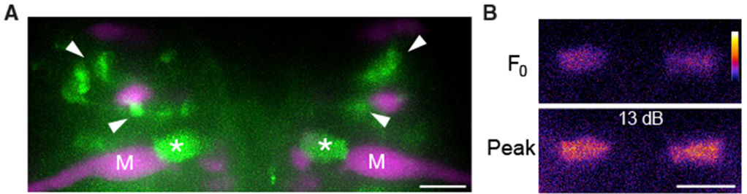
Spiral fiber neurons excite the M-cell at its axon cap
A second excitatory pathway reaches the M-cell. Spiral fiber neurons are hindbrain interneurons whose axons cross to the opposite M-cell and wrap around its axon hillock, where the axon leaves the cell body, inside a structure called the axon cap.
Lacoste and colleagues found by calcium imaging that spiral fiber neurons are active in response to aversive stimuli that elicit escapes. Bilateral ablation of these neurons largely eliminated short-latency escapes, like M-cell ablation, and unilateral ablation shifted escape direction. Optogenetic activation increased the probability of short-latency escapes.
Marsden and colleagues imaged spiral fiber neurons expressing GCaMP, a calcium indicator that brightens when neurons are active (green), together with the M-cells (magenta). Their axon terminals in the axon cap brightened after a strong acoustic stimulus. The M-cell therefore receives auditory excitation at two sites: directly on the lateral dendrite and indirectly at the axon hillock.
Marsden et al. (2018), Fig. 4A–B. Spiral fiber neurons (green; arrowheads) and their axon-cap terminals (*) beside the M-cells (magenta); calcium signal at peak.
Lacoste et al. (2015); Marsden et al. (2018)
22
Notes:
• The club endings are not the only excitatory input.
– Spiral fiber neurons are interneurons whose axons cross to the opposite Mauthner cell and coil around its axon hillock, the point where the axon leaves the cell body, inside the axon cap.
• Lacoste and colleagues showed these neurons are essential.
– Calcium imaging found them active when a stimulus could trigger an escape.
– Killing them on both sides removed most short-latency escapes, much like killing the Mauthner cells, and killing them on one side shifted which way the fish turned.
– Activating them with light made short-latency escapes more likely.
• Marsden and colleagues imaged the spiral fiber terminals in the axon cap with a calcium indicator, and they brightened after a strong sound. Auditory excitation therefore reaches the Mauthner cell at two places, the dendrite and the axon hillock.
References:
Lacoste AM, Schoppik D, Robson DN, Haesemeyer M, Portugues R, Li JM, Randlett O, Wee CL, Engert F, Schier AF (2015). A convergent and essential interneuron pathway for Mauthner-cell-mediated escapes. Current Biology 25(11): 1526–1534. https://doi.org/10.1016/j.cub.2015.04.025
Marsden KC, Jain RA, Wolman MA, Echeverry FA, Nelson JC, Hayer KE, Miltenberg B, Pereda AE, Granato M (2018). A Cyfip2-dependent excitatory interneuron pathway establishes the innate startle threshold. Cell Reports 23(3): 878–887. https://doi.org/10.1016/j.celrep.2018.03.095
Figure: Marsden et al. (2018), Fig. 4A–B. Spiral fiber neurons (green; arrowheads) and their axon-cap terminals (*) beside the M-cells (magenta); calcium signal at peak.
Figure source: https://doi.org/10.1016/j.celrep.2018.03.095

Slide 29
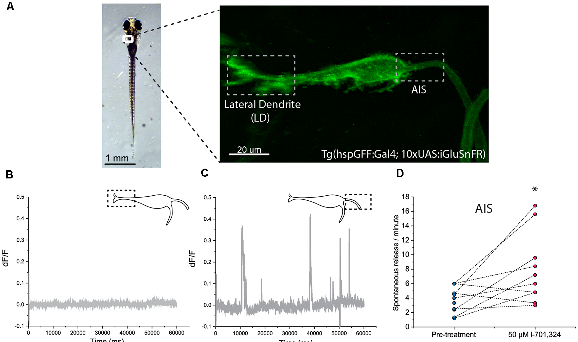
Glutamate release differs at the dendrite and initial segment
Bátora and colleagues expressed iGluSnFR, a fluorescent sensor that brightens when glutamate binds to it, on the M-cell surface. They then imaged two sites: the lateral dendrite (LD), which receives VIIIth-nerve input, and the axon initial segment (AIS), which receives spiral fiber input inside the axon cap.
The two sites behaved differently at rest. No spontaneous glutamate release was detected at the LD during 1-minute recordings, whereas the AIS showed frequent spontaneous release events. Blocking NMDA receptors with L-701,324 increased the rate of spontaneous release at the AIS.
Acoustic stimuli evoked glutamate transients at both sites. Release at the AIS was regulated by NMDA receptors and set the sensitivity of the startle, whereas release at the LD was not modulated by NMDA receptor activity and provided a baseline component of M-cell activation. A single command neuron can therefore have functionally distinct input domains.
Bátora et al. (2021), Fig. 2A–D. iGluSnFR on the M-cell: lateral dendrite and AIS regions; spontaneous release at the AIS but not the LD.
Bátora et al. (2021)
23
Notes:
• Bátora and colleagues watched glutamate arriving at the Mauthner cell directly.
– iGluSnFR is a protein sensor placed on the cell surface that fluoresces when glutamate binds, so release shows up as a flash of light.
– They imaged the lateral dendrite, where auditory afferents end, and the axon initial segment, where spiral fiber terminals end.
• At rest, the two sites were completely different.
– The lateral dendrite was silent, while the axon initial segment had frequent spontaneous release events.
– Blocking NMDA receptors made the spontaneous release at the initial segment more frequent.
• During acoustic stimulation, release at the axon initial segment depended on NMDA receptors and set how sensitive the startle was, while release at the lateral dendrite was a steady baseline drive not affected by NMDA receptors.
References:
Bátora D, Zsigmond Á, Lőrincz IZ, Szegvári G, Varga M, Málnási-Csizmadia A (2021). Subcellular dissection of a simple neural circuit: functional domains of the Mauthner-cell during habituation. Frontiers in Neural Circuits 15: 648487. https://doi.org/10.3389/fncir.2021.648487
Figure: Bátora et al. (2021), Fig. 2A–D. iGluSnFR on the M-cell: lateral dendrite and AIS regions; spontaneous release at the AIS but not the LD.
Figure source: https://doi.org/10.3389/fncir.2021.648487

Slide 30
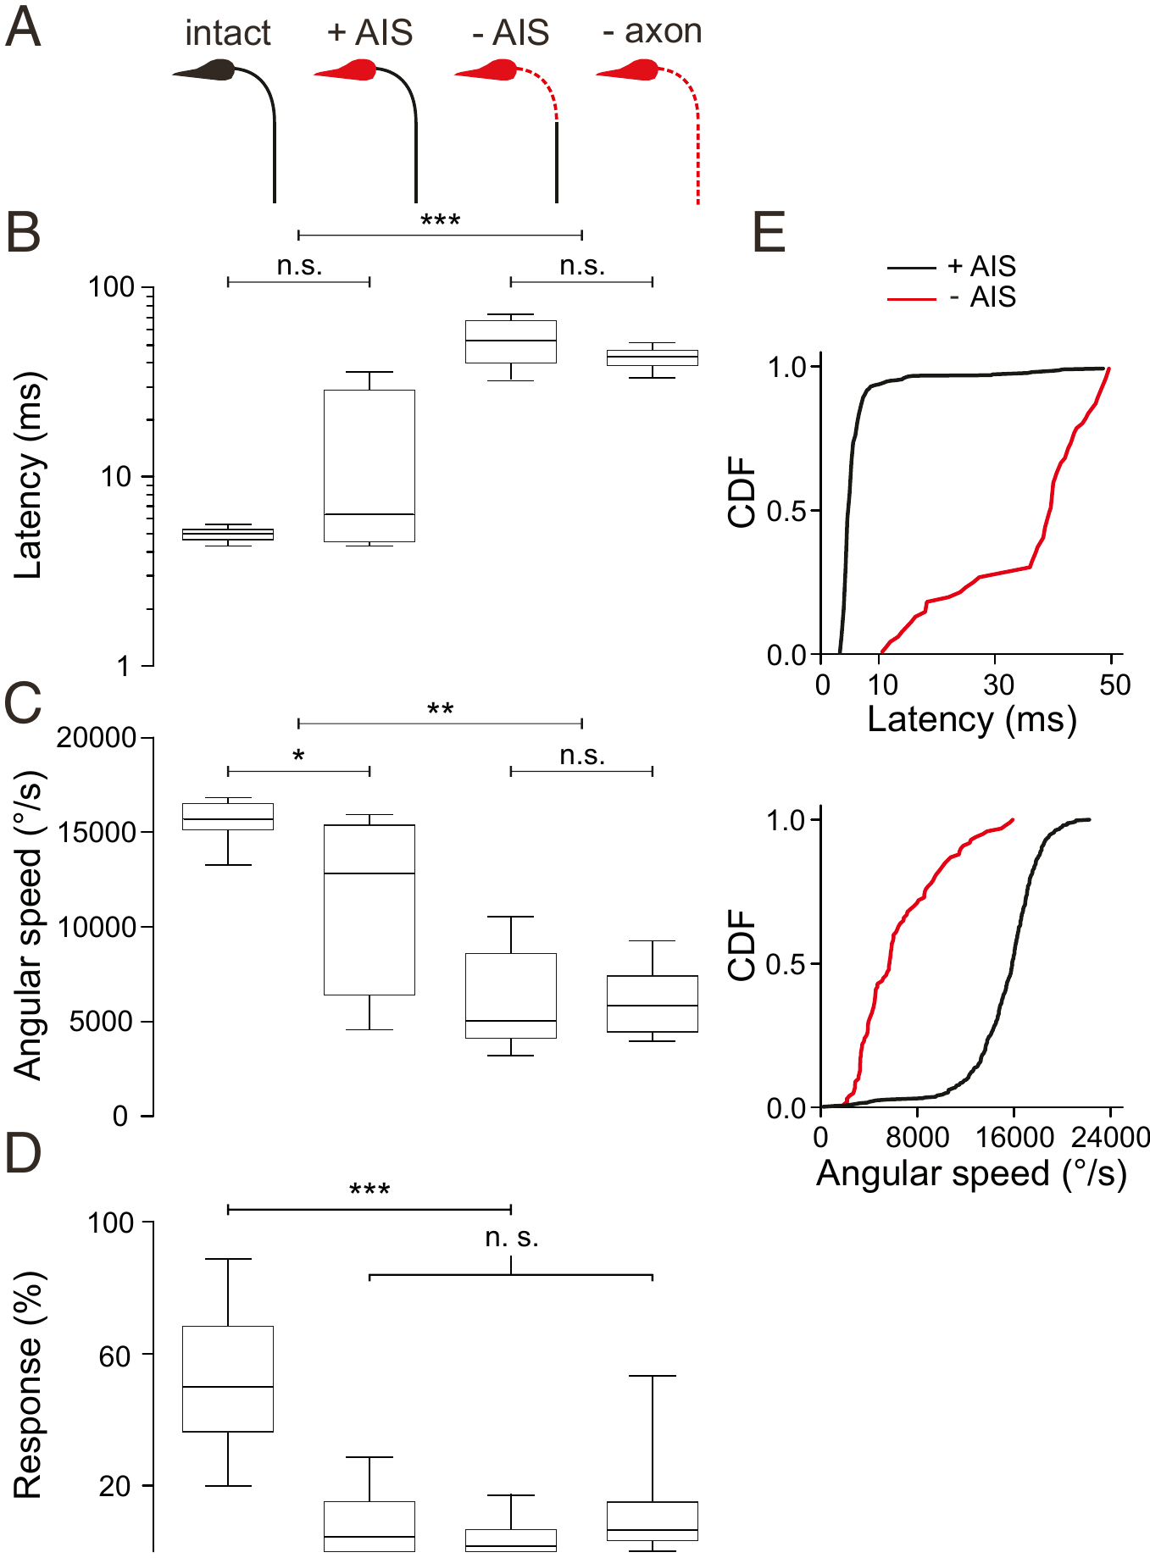
The axon initial segment integrates escape-triggering input
After a laser ablation of the M-cell soma, the axon does not disappear at once. Hecker and colleagues followed individual larvae as the M-cell degenerated and measured escapes that would recruit that cell at each stage.
While the soma was gone but the axon initial segment (AIS) and axon remained, rapid short-latency escapes still occurred, with near-normal latency. Once the AIS was lost, latencies jumped to tens of milliseconds and angular speed fell, even though the rest of the axon was still present. Losing the axon as well made no further difference.
Response probability, however, dropped as soon as the soma was lost. The soma and its huge dendrites are needed for reliable triggering, but the AIS is sufficient for high-speed escapes. All the inputs that can still drive a fast escape after the soma is lost, including the spiral fiber input of the axon cap, are sampled at the initial segment.
Hecker et al. (2020), Fig. 2A–E. Escape latency, angular speed and probability at stages of M-cell degeneration (intact, +AIS, −AIS, −axon).
Hecker et al. (2020)
24
Notes:
• Hecker and colleagues used the slow death of an ablated Mauthner cell as an experiment.
– After the cell body is destroyed with a laser, the axon survives for a while, and they could check its state and test escapes in the same larva over time.
• The axon initial segment turned out to be the critical piece.
– With the soma gone but the initial segment present, fast short-latency escapes still happened.
– Once the initial segment was lost, escapes became slow, with latencies of tens of milliseconds and much lower turning speed, even with the rest of the axon still there.
• The soma still matters for something.
– As soon as the soma was gone, escapes became much less likely, so the dendrites and soma are needed for the cell to be triggered reliably.
– The inputs that can still produce a fast escape without the soma, such as the spiral fibers in the axon cap, act at the initial segment.
References:
Hecker A, Schulze W, Oster J, Richter DO, Schuster S (2020). Removing a single neuron in a vertebrate brain forever abolishes an essential behavior. Proceedings of the National Academy of Sciences USA 117(6): 3254–3260. https://doi.org/10.1073/pnas.1918578117
Figure: Hecker et al. (2020), Fig. 2A–E. Escape latency, angular speed and probability at stages of M-cell degeneration (intact, +AIS, −AIS, −axon).
Figure source: https://doi.org/10.1073/pnas.1918578117

Slide 31
The axon initial segment is where input becomes a spike
In most neurons the action potential starts at the axon initial segment, the first stretch of axon beyond the soma, where threshold is lowest. Dendritic potentials must spread passively to this zone and shrink on the way; input on the initial segment acts where the spike is generated.
This explains the degenerating M-cells. Spiral fiber terminals contact the initial segment, so they can still fire the axon once soma and dendrites are gone. The soma and dendrites collect the club-ending and visual drive that makes triggering reliable, so their loss cut response probability. Hecker and colleagues suggest the large soma normally drains current from the initial segment, so its removal may strengthen axon-cap input.
Two excitatory routes, differing in location and timing, thus converge on the initiation site, a feedforward motif that Lacoste and colleagues argue ensures reliable activation.
Hecker et al. (2020), Fig. 2A–E. Escape latency, angular speed and probability at stages of M-cell degeneration (intact, +AIS, −AIS, −axon).
Hecker et al. (2020); Lacoste et al. (2015); Bátora et al. (2021)
24a
Notes:
• Slide 24 separates what the soma provides from what the initial segment provides; the explanation comes from where spikes are generated.
• Spike initiation has a preferred site.
– In a typical neuron the initial segment reaches threshold first, so synaptic potentials from anywhere in the cell are judged there.
– Dendritic input on the M-cell lateral dendrite, slide 14, has a long passive path to travel; spiral fiber input on slide 22 arrives at the initiation zone itself.
• The degeneration stages map onto this arrangement.
– Hecker and colleagues found fast escapes with near-normal latency as long as the initial segment survived, and slow escapes once it was gone, whatever the state of the rest of the axon.
– They also argue that the soma acts as a current sink for initial-segment inputs, so ablating it may raise the efficiency of those inputs, which cautions against reading their strength in an intact cell from the ablation result.
• Two converging routes make the decision robust.
– Bátora and colleagues, slide 23, found that release at the initial segment is NMDA-regulated and sets startle sensitivity, while release at the lateral dendrite provides a steadier baseline.
– Slide 41 adds that changing only the spiral fiber route, in cyfip2 mutants, shifts the whole startle threshold, which fits an initiation zone where small changes in input decide whether the cell fires.
References:
Hecker A, Schulze W, Oster J, Richter DO, Schuster S (2020). Removing a single neuron in a vertebrate brain forever abolishes an essential behavior. Proceedings of the National Academy of Sciences USA 117(6): 3254–3260. https://doi.org/10.1073/pnas.1918578117
Lacoste AM, Schoppik D, Robson DN, Haesemeyer M, Portugues R, Li JM, Randlett O, Wee CL, Engert F, Schier AF (2015). A convergent and essential interneuron pathway for Mauthner-cell-mediated escapes. Current Biology 25(11): 1526–1534. https://doi.org/10.1016/j.cub.2015.04.025
Bátora D, Zsigmond Á, Lőrincz IZ, Szegvári G, Varga M, Málnási-Csizmadia A (2021). Subcellular dissection of a simple neural circuit: functional domains of the Mauthner-cell during habituation. Frontiers in Neural Circuits 15: 648487. https://doi.org/10.3389/fncir.2021.648487

Slide 32
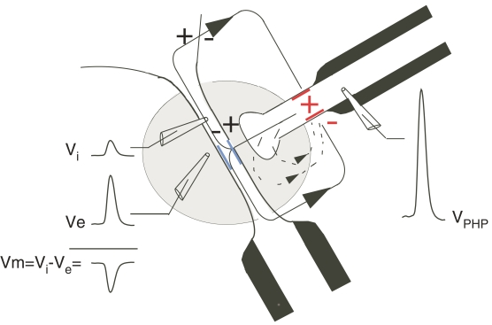
The axon cap makes inhibition electrical
The axon cap is a specialized region around the M-cell axon hillock with an extracellular resistance about ninefold higher than that of the surrounding tissue. The unmyelinated terminal branches of feedforward inhibitory interneurons penetrate it.
When these interneurons fire, current generated at the last node of Ranvier of their myelinated axons flows out passively at their terminals in the cap. Because the cap's high resistance limits the return path, part of that current flows inward across the M-cell membrane at the axon hillock. Intracellular minus extracellular voltage then becomes more negative: the M-cell is hyperpolarized by an extrinsic hyperpolarizing potential (EHP), an electrical inhibition produced by an extracellular field.
The same interneurons also release glycine, producing a conventional inhibitory postsynaptic potential (IPSP). Fukami and colleagues measured M-cell excitability directly and found that the EHP suppressed it about as strongly as the IPSP did.
Weiss & Faber (2010), Fig. 3. Electrical inhibition at the axon cap: an inhibitory interneuron spike (V_PHP) hyperpolarizes the M-cell axon hillock.
Weiss & Faber (2010); Fukami et al. (1965); Korn & Faber (2005)
25
Notes:
• The axon cap is a small region around the Mauthner axon hillock with an unusually high extracellular resistance, about nine times that of the surrounding tissue.
– The terminals of feedforward inhibitory interneurons run into it.
• When those interneurons fire, current flows out of their terminals into the cap.
– Because the cap resists current flowing back out, some of it crosses into the Mauthner cell at the axon hillock.
– The outside of the cell becomes more positive relative to the inside, so the membrane is hyperpolarized; this is the extrinsic hyperpolarizing potential, or EHP, an inhibition carried by an electric field instead of a transmitter.
• The same interneurons also release glycine, which opens chloride channels and gives an ordinary inhibitory postsynaptic potential.
– Fukami and colleagues tested the Mauthner cell's excitability with current pulses and found that the electrical EHP inhibited it about as strongly as the chemical IPSP did.
References:
Weiss SA, Faber DS (2010). Field effects in the CNS play functional roles. Frontiers in Neural Circuits 4: 15. https://doi.org/10.3389/fncir.2010.00015
Fukami Y, Furukawa T, Asada Y (1965). Excitability changes of the Mauthner cell during collateral inhibition. Journal of General Physiology 48(4): 581–600. https://doi.org/10.1085/jgp.48.4.581
Korn H, Faber DS (2005). The Mauthner cell half a century later: a neurobiological model for decision-making? Neuron 47(1): 13–28. https://doi.org/10.1016/j.neuron.2005.05.019
Figure: Weiss & Faber (2010), Fig. 3. Electrical inhibition at the axon cap: an inhibitory interneuron spike (V_PHP) hyperpolarizes the M-cell axon hillock.
Figure source: https://doi.org/10.3389/fncir.2010.00015

Slide 33
Field inhibition acts as fast as the excitation it opposes
The EHP and the glycinergic IPSP arise from the same interneuron spikes. The IPSP needs glycine release and chloride channel opening, so it begins after a synaptic delay and inhibits mainly by raising membrane conductance. The EHP needs no transmitter; it lasts only while the interneurons' action currents flow, so it starts the instant those spikes arrive.
Timing makes the field effect useful. According to Weiss and Faber, the M-cell's utilization time, the interval in which excitation must carry it to threshold, can be as short as 400 µs. Only inhibition as fast as electrotonic excitation acts within that window; in freely swimming fish it coincided with the M-spike in about 45% of trials.
The two also differ in where they act. Fukami and colleagues found that the EHP blocked antidromic spikes from invading the M-cell while the IPSP did not, although both reduced the response to injected current. Electrical inhibition guards the hillock where the spike starts; chemical inhibition shunts the soma.
Weiss & Faber (2010), Fig. 3. Electrical inhibition at the axon cap: an inhibitory interneuron spike (V_PHP) hyperpolarizes the M-cell axon hillock.
Weiss & Faber (2010); Fukami et al. (1965); Weiss et al. (2008)
25a
Notes:
• Slide 25 describes how the axon cap produces an extrinsic hyperpolarizing potential; the reason this matters is that it is the only inhibition fast enough to compete with electrical excitation.
• Two inhibitions, one source.
– Each feedforward interneuron spike both releases glycine and generates current in the axon cap.
– The glycinergic potential has to wait for release and receptor opening, whereas the field effect is simply the current itself crossing the M-cell membrane.
• The race against excitation is very short.
– The club-ending excitation on slide 14 is electrical and nearly instantaneous, and Weiss and Faber describe a utilization time as brief as 400 microseconds.
– Weiss and colleagues found the electrical inhibition timed with the excitatory drive and, in free-swimming fish, coincident with M-spike latency in about 45 percent of trials, which is why they conclude it helps set the behavioral threshold on slide 26.
• The two forms have separable effects.
– Fukami and colleagues probed the cell with intracellular current pulses and with antidromic spikes.
– The EHP stopped antidromic invasion at the hillock, while the IPSP's conductance increase left invasion intact, so the field effect acts precisely where the outgoing spike would be generated.
References:
Weiss SA, Faber DS (2010). Field effects in the CNS play functional roles. Frontiers in Neural Circuits 4: 15. https://doi.org/10.3389/fncir.2010.00015
Fukami Y, Furukawa T, Asada Y (1965). Excitability changes of the Mauthner cell during collateral inhibition. Journal of General Physiology 48(4): 581–600. https://doi.org/10.1085/jgp.48.4.581
Weiss SA, Preuss T, Faber DS (2008). A role of electrical inhibition in sensorimotor integration. Proceedings of the National Academy of Sciences USA 105(46): 18047–18052. https://doi.org/10.1073/pnas.0806145105

Slide 34
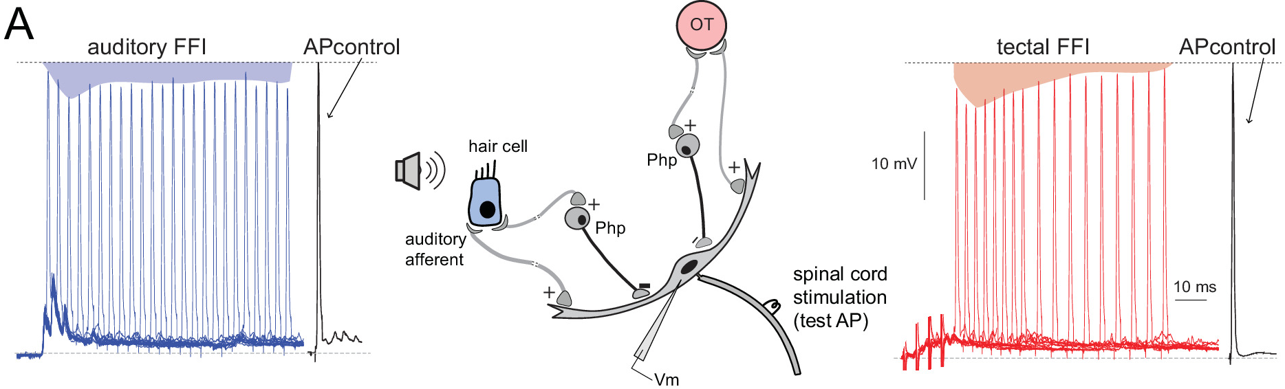
Feedforward inhibition helps set the startle threshold
An abrupt sound excites the M-cell and, at the same moment, a population of inhibitory interneurons. Weiss and colleagues found that such sounds produce synchronized spikes in 20 or more of these interneurons, generating feedforward electrical inhibition of the M-cell. Feedforward means that the same sensory input drives both the excitation and the inhibition.
The electrical inhibition coincided with the electrotonic excitation, and its peak was about 40% of the excitation's amplitude. Cancelling it with an extracellular current pulse converted subthreshold auditory stimuli into ones that made the M-cell fire. Inhibition therefore raises the threshold of the startle.
Otero-Coronel and colleagues measured feedforward inhibition in goldfish as the reduction of an antidromic test spike, shunted by the inhibitory conductance. Auditory and tectal (visual) stimuli both produced it with similar peak strength, but tectal inhibition decayed faster.
Otero-Coronel et al. (2024), Fig. 3A. Auditory and tectal feedforward inhibition reduce a test spike in the M-cell (shaded areas); circuit with Php interneurons.
Weiss et al. (2008); Otero-Coronel et al. (2024)
26
Notes:
• The sound that excites the Mauthner cell also drives the inhibitory interneurons around it, so inhibition arrives in parallel with excitation; that arrangement is called feedforward inhibition.
– Weiss and colleagues found that an abrupt sound makes 20 or more of these interneurons fire together.
• Their electrical inhibition lined up in time with the electrical excitation from the club endings and reached about 40 percent of its size.
– When the experimenters cancelled the inhibition with a current pulse applied outside the cell, sounds that were normally too weak to make the Mauthner cell fire now triggered a spike.
– Inhibition is therefore part of what sets the threshold of the startle.
• Otero-Coronel and colleagues measured feedforward inhibition by how much it shrank a test spike sent backward into the Mauthner cell.
– Sound and visual input from the tectum both produced this shunting inhibition with a similar peak, but the visual inhibition faded faster.
References:
Weiss SA, Preuss T, Faber DS (2008). A role of electrical inhibition in sensorimotor integration. Proceedings of the National Academy of Sciences USA 105(46): 18047–18052. https://doi.org/10.1073/pnas.0806145105
Otero-Coronel S, Preuss T, Medan V (2024). Multisensory integration enhances audiovisual responses in the Mauthner cell. eLife 13: RP99424. https://doi.org/10.7554/eLife.99424
Figure: Otero-Coronel et al. (2024), Fig. 3A. Auditory and tectal feedforward inhibition reduce a test spike in the M-cell (shaded areas); circuit with Php interneurons.
Figure source: https://doi.org/10.7554/eLife.99424

Slide 35
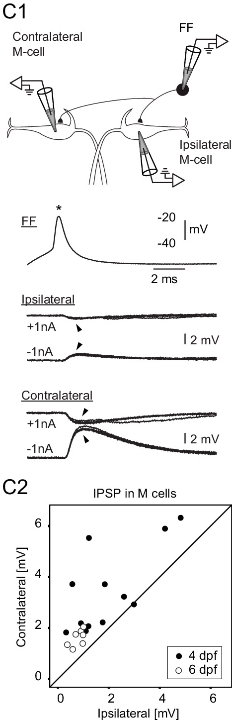
FF neurons inhibit the opposite M-cell more strongly
Koyama and colleagues identified the feedforward (FF) inhibitory neurons of the larval escape circuit: glycinergic interneurons beside each M-cell that receive eighth-nerve input and inhibit both M-cells.
They recorded an FF neuron together with one M-cell. A spike in the FF neuron produced an inhibitory postsynaptic potential (IPSP) in the M-cell on its own side and in the M-cell on the opposite side. In most pairs the contralateral IPSP was larger. Counts of FF synaptic contacts gave the same answer: each FF neuron made more contacts on the opposite M-cell.
FF neurons on the two sides also inhibited each other. Sensory input from one side therefore excites the M-cell on that side, inhibits the opposite M-cell more strongly, and suppresses the opposite FF neurons. A computational model of this connectivity predicted a decision in which only one M-cell fires.
Koyama et al. (2016), Fig. 1C. Paired recordings: an FF spike evokes IPSPs in ipsilateral and contralateral M-cells; contralateral IPSPs are larger (C2).
Koyama et al. (2016)
27
Notes:
• The feedforward inhibitory neurons are glycinergic cells sitting next to each Mauthner cell, driven by the same eighth-nerve input that drives the Mauthner cell.
– Koyama and colleagues recorded from one of these neurons and a Mauthner cell at the same time to measure the connection.
• A spike in a feedforward neuron inhibited both Mauthner cells, but usually the one on the opposite side more strongly.
– The anatomy matched: each feedforward neuron made more synaptic contacts on the opposite Mauthner cell.
• The feedforward neurons on the two sides also inhibit each other.
– A sound from the left therefore excites the left Mauthner cell, strongly inhibits the right one, and suppresses the right-side inhibitory neurons that would have opposed the left cell.
– Their computational model of this wiring produced a winner-take-all choice of one Mauthner cell.
References:
Koyama M, Minale F, Shum J, Nishimura N, Schaffer CB, Fetcho JR (2016). A circuit motif in the zebrafish hindbrain for a two alternative behavioral choice to turn left or right. eLife 5: e16808. https://doi.org/10.7554/eLife.16808
Figure: Koyama et al. (2016), Fig. 1C. Paired recordings: an FF spike evokes IPSPs in ipsilateral and contralateral M-cells; contralateral IPSPs are larger (C2).
Figure source: https://doi.org/10.7554/eLife.16808

Slide 36
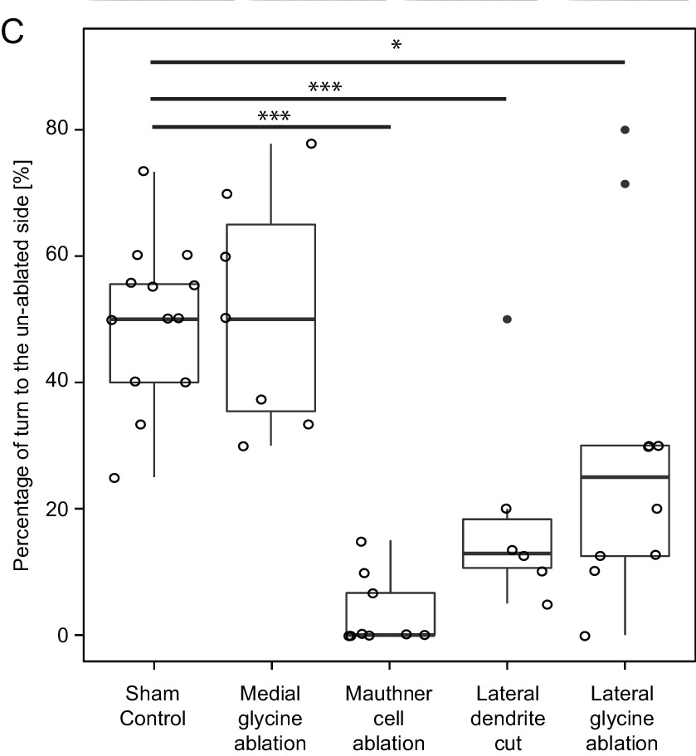
Losing one side's FF neurons biases escape direction
Koyama and colleagues tested the model by laser ablation followed by behavior. Vibrating the dish provided an omnidirectional stimulus, so intact larvae turned left and right equally often.
Killing one M-cell left almost no short-latency escapes initiated by the lesioned side. Cutting off one M-cell's lateral dendrite also biased responses: only about 13% of escapes came from the lesioned side, consistent with the loss of excitatory input onto the cut dendrite.
Ablating part of the lateral feedforward inhibitory population on one side shifted 70–75% of escapes to the intact side, as the model predicted; ablating nearby medial glycinergic neurons did not. With a stimulus delivered to one side, removing FF neurons shortened escape latency on the lesioned side. The inhibitory connections are therefore part of the mechanism that chooses left versus right.
Koyama et al. (2016), Fig. 10C. Percentage of escapes turning toward the un-ablated side after each lesion; sham controls near 50%.
Koyama et al. (2016)
28
Notes:
• To test the model, Koyama and colleagues destroyed specific neurons with a laser and watched escapes to a vibration that came from no particular side.
– Normal larvae turned left half the time and right half the time.
• Each lesion pushed that balance in a predictable direction.
– Killing one Mauthner cell meant almost no short-latency escapes started from that side.
– Cutting off one Mauthner cell's lateral dendrite cut its sensory input, and only about 13 percent of escapes came from that side.
• The key test was ablating feedforward inhibitory neurons on one side.
– About 70 to 75 percent of escapes then came from the intact side, as the model predicted, while killing nearby medial glycinergic neurons had no effect.
– With a stimulus to one side, removing the feedforward neurons shortened the escape latency on that side, so these neurons normally delay and gate the Mauthner response.
References:
Koyama M, Minale F, Shum J, Nishimura N, Schaffer CB, Fetcho JR (2016). A circuit motif in the zebrafish hindbrain for a two alternative behavioral choice to turn left or right. eLife 5: e16808. https://doi.org/10.7554/eLife.16808
Figure: Koyama et al. (2016), Fig. 10C. Percentage of escapes turning toward the un-ablated side after each lesion; sham controls near 50%.
Figure source: https://doi.org/10.7554/eLife.16808

Slide 37
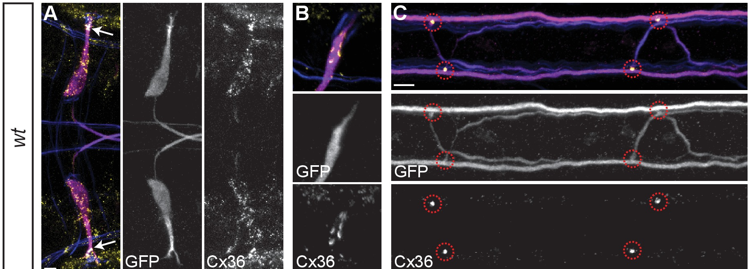
Spinal CoLo neurons silence a late second M-cell command
In goldfish, Fetcho and Faber found that both classes of spinal neurons excited by one M-axon are inhibited, through two synapses, by the other M-axon. The inhibition is mediated by interneurons that are electrically coupled to one M-axon and send a process across the cord.
Satou and colleagues identified these neurons in zebrafish as CoLo (commissural local) interneurons, one per hemisegment. An M-spike evoked a CoLo spike through electrical transmission, and CoLos made inhibitory synapses onto contralateral primary motoneurons. They were active only during escapes.
After CoLo ablation, sound-evoked escapes were often impaired, with a reduced initial bend. The evidence indicated that these failures occurred when both M-cells fired: normally CoLos silence the output of the slightly delayed second M-cell. Spinal circuits can therefore filter a conflicting descending command.
Miller et al. (2017), Fig. 3A–C. Mauthner cells and axons (magenta) and M/CoLo synapses in two spinal segments (circles), labeled for Cx36.
Satou et al. (2009); Fetcho & Faber (1988); Miller et al. (2017)
29
Notes:
• Fetcho and Faber found a crossed inhibitory pathway in the goldfish spinal cord.
– Neurons excited by one Mauthner axon are inhibited, after two synapses, by the other Mauthner axon, through interneurons electrically coupled to the axon that send a branch across the cord.
• Satou and colleagues identified these cells in zebrafish as CoLo neurons, short for commissural local.
– There is one CoLo in each half of each spinal segment.
– A Mauthner spike triggers a CoLo spike through the gap junction, and the CoLo then inhibits the primary motoneurons on the other side; CoLos fire only during escapes.
• Ablating CoLos weakened the escape.
– Sound-evoked escapes often had a smaller initial bend, and the evidence pointed to trials in which both Mauthner cells fired.
– Normally, the CoLos activated by the first Mauthner cell block the output of the second one, which fires slightly later, so the body still bends to one side.
References:
Satou C, Kimura Y, Kohashi T, Horikawa K, Takeda H, Oda Y, Higashijima S (2009). Functional role of a specialized class of spinal commissural inhibitory neurons during fast escapes in zebrafish. Journal of Neuroscience 29(21): 6780–6793. https://doi.org/10.1523/JNEUROSCI.0801-09.2009
Fetcho JR, Faber DS (1988). Identification of motoneurons and interneurons in the spinal network for escapes initiated by the Mauthner cell in goldfish. Journal of Neuroscience 8(11): 4192–4213. https://doi.org/10.1523/JNEUROSCI.08-11-04192.1988
Miller AC, Whitebirch AC, Shah AN, Marsden KC, Granato M, O'Brien J, Moens CB (2017). A genetic basis for molecular asymmetry at vertebrate electrical synapses. eLife 6: e25364. https://doi.org/10.7554/eLife.25364
Figure: Miller et al. (2017), Fig. 3A–C. Mauthner cells and axons (magenta) and M/CoLo synapses in two spinal segments (circles), labeled for Cx36.
Figure source: https://doi.org/10.7554/eLife.25364

Slide 38
Two layers of crossed inhibition keep the bend one-sided
Each side of the escape circuit guards against the other at two levels. In the hindbrain, feedforward neurons inhibit the opposite M-cell about 2.4 times as strongly as their own, so the side receiving stronger sound usually silences its partner first.
Sounds still often activate both M-cells, the second slightly after the first. The cord then supplies a second level: the first M-spike excites CoLo neurons electrically along the cord, and CoLos inhibit the opposite primary motoneurons before the late command arrives.
The design separates choosing a side from protecting the choice. Hindbrain inhibition decides which cell fires; spinal inhibition makes the motor output one-sided even when the decision is not. Losing either level has its own defect: a biased side without feedforward neurons, weak or S-shaped bends without CoLos or their electrical synapses.
Miller et al. (2017), Fig. 3A–C. Mauthner cells and axons (magenta) and M/CoLo synapses in two spinal segments (circles), labeled for Cx36.
Koyama et al. (2016); Satou et al. (2009); Marquart et al. (2019)
29a
Notes:
• Slides 27 to 29 describe crossed inhibition twice, once around the M-cells and once in the spinal cord; together they form a two-stage safeguard for a single direction of bending.
• The first stage works on the M-cells themselves.
– Koyama and colleagues found the contralateral IPSP larger than the ipsilateral one in 18 of 19 triple recordings, with an average ratio near two and a half.
– The sound reaches the near ear's afferents first and most strongly, the near-side inhibitory neurons get a head start in suppressing the far M-cell.
• The second stage handles the cases the first misses.
– Marquart and colleagues point out that sounds often activate both M-cells, and Satou and colleagues traced impaired escapes in CoLo-ablated larvae to such double firing.
– Since the CoLos are electrically coupled to the M-axon, as Fetcho and Faber found in goldfish, they fire almost as soon as the first M-spike passes and inhibit the opposite motoneurons in time.
• Each defect points to its stage.
– On slide 28, removing feedforward neurons on one side biases escapes toward the intact side, a fault in choosing.
– Slide 21 shows kinked or S-shaped startles when M-axon to CoLo electrical synapses are missing, a fault in protecting the choice.
References:
Koyama M, Minale F, Shum J, Nishimura N, Schaffer CB, Fetcho JR (2016). A circuit motif in the zebrafish hindbrain for a two alternative behavioral choice to turn left or right. eLife 5: e16808. https://doi.org/10.7554/eLife.16808
Satou C, Kimura Y, Kohashi T, Horikawa K, Takeda H, Oda Y, Higashijima S (2009). Functional role of a specialized class of spinal commissural inhibitory neurons during fast escapes in zebrafish. Journal of Neuroscience 29(21): 6780–6793. https://doi.org/10.1523/JNEUROSCI.0801-09.2009
Marquart GD, Tabor KM, Bergeron SA, Briggman KL, Burgess HA (2019). Prepontine non-giant neurons drive flexible escape behavior in zebrafish. PLoS Biology 17(10): e3000480. https://doi.org/10.1371/journal.pbio.3000480
Fetcho JR, Faber DS (1988). Identification of motoneurons and interneurons in the spinal network for escapes initiated by the Mauthner cell in goldfish. Journal of Neuroscience 8(11): 4192–4213. https://doi.org/10.1523/JNEUROSCI.08-11-04192.1988
Lasseigne AM, Echeverry FA, Ijaz S, Michel JC, Martin EA, Marsh AJ, Trujillo E, Marsden KC, Pereda AE, Miller AC (2021). Electrical synaptic transmission requires a postsynaptic scaffolding protein. eLife 10: e66898. https://doi.org/10.7554/eLife.66898

Slide 39
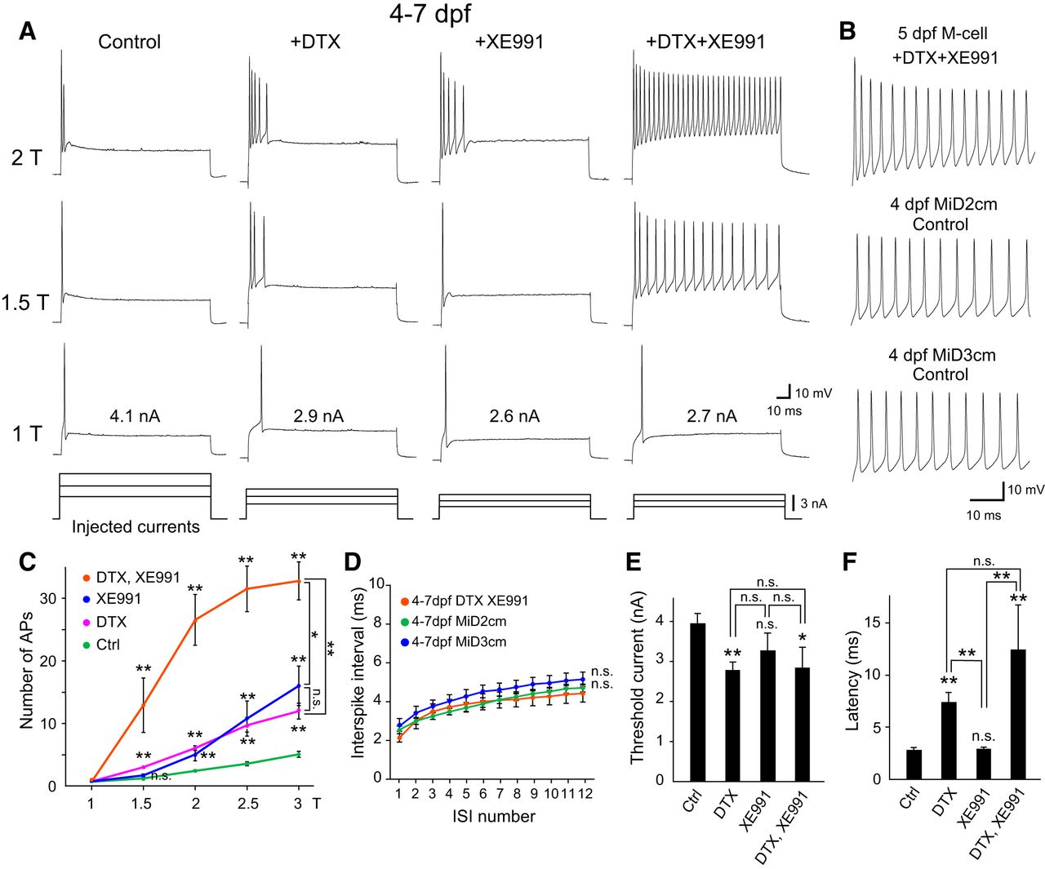
Two potassium channels let the M-cell fire only once
Mature larval M-cells (4–7 days after fertilization) respond to a long depolarizing current step with a single spike at its onset. Watanabe and colleagues tested which potassium (K+) channels enforce this.
Dendrotoxin (DTX) blocks Kv1 channels, and XE991 blocks Kv7/KCNQ channels; both are low-threshold K+ channels that open near the resting potential. Blocking either channel alone turned the single spike into a short phasic burst of spikes. Blocking both made the M-cell fire tonically throughout the step, like its homologs MiD2cm and MiD3cm, which fire repetitively without any drug.
The single spike of the M-cell is therefore not built into its shape or size. It depends on two outward currents that open as the cell depolarizes and terminate firing after the first spike. Repeated firing returns as soon as both are removed.
Watanabe et al. (2017), Fig. 1. Firing of 4–7 dpf M-cells before and after DTX and/or XE991, compared with MiD2cm and MiD3cm; spike counts and latency.
Watanabe et al. (2017)
30
Notes:
• Mature Mauthner cells answer a long current step with just one spike at the start.
– Watanabe and colleagues asked which potassium channels are responsible.
• They used two blockers.
– Dendrotoxin blocks Kv1 channels, and XE991 blocks Kv7, also called KCNQ, channels; both are low-threshold potassium channels that start to open close to the resting potential.
– Blocking either one turned the single spike into a short burst, and blocking both made the cell fire continuously through the whole step.
• With both blocked, the Mauthner cell fired like MiD2cm and MiD3cm, its homologs, which fire repetitively on their own.
– The single spike comes from these two potassium currents, which turn on as the cell depolarizes and stop it from firing again.
References:
Watanabe T, Shimazaki T, Oda Y (2017). Coordinated expression of two types of low-threshold K+ channels establishes unique single spiking of Mauthner cells among segmentally homologous neurons in the zebrafish hindbrain. eNeuro 4(5): ENEURO.0249-17.2017. https://doi.org/10.1523/ENEURO.0249-17.2017
Figure: Watanabe et al. (2017), Fig. 1. Firing of 4–7 dpf M-cells before and after DTX and/or XE991, compared with MiD2cm and MiD3cm; spike counts and latency.
Figure source: https://doi.org/10.1523/ENEURO.0249-17.2017

Slide 40
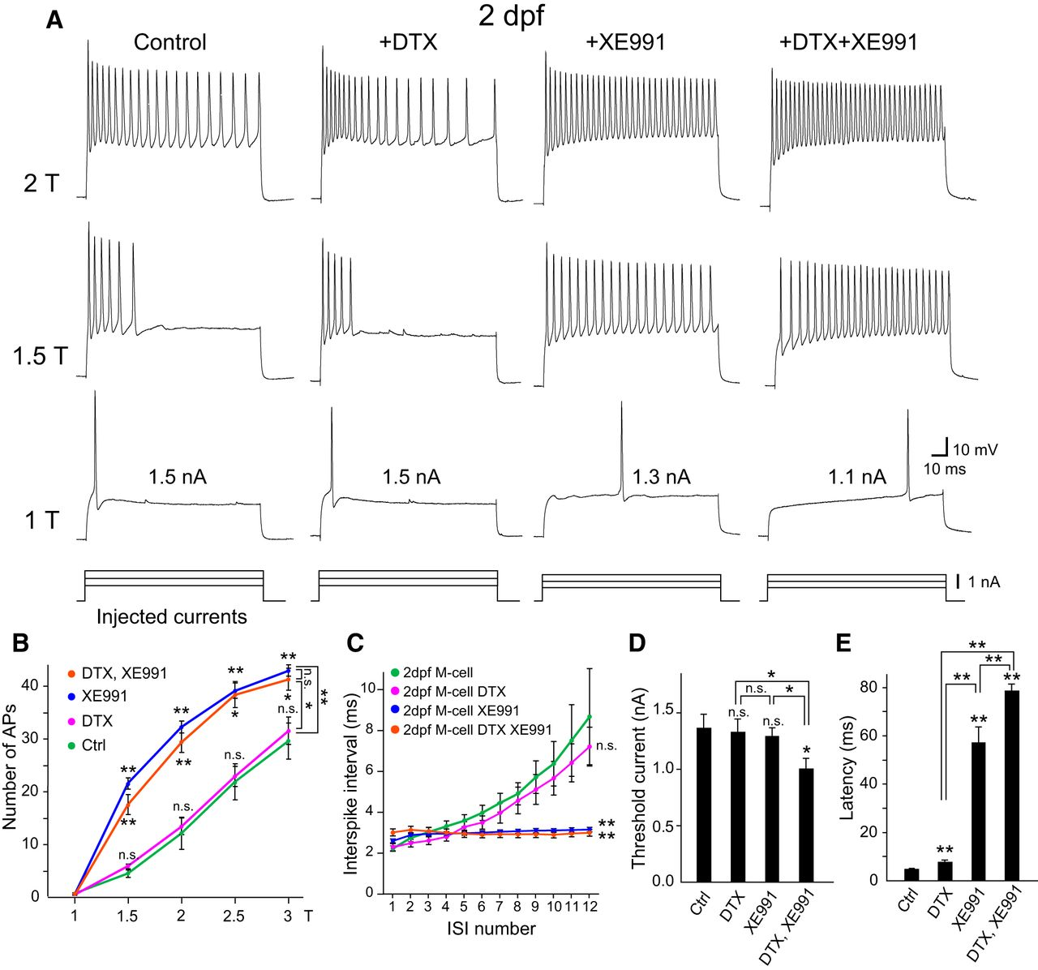
Single spiking develops between 2 and 4 days of age
At 2 days after fertilization, M-cells do not yet fire single spikes. A current step evokes a phasic burst: a train of spikes whose intervals lengthen until firing stops, a pattern called spike-frequency adaptation.
At this age XE991 converted the burst into tonic firing with constant intervals, whereas DTX had almost no effect beyond a slight delay of the first spike. In situ hybridization detected Kv7.4 mRNA specifically in M-cells at 2 dpf. Kv7.4 therefore generates the adaptation of the immature M-cell.
The earlier study cited by Watanabe and colleagues showed that M-cells acquire single spiking at 4 dpf when they begin to express the auxiliary subunit Kvβ2, which acts on Kv1.1 channels present throughout the Mauthner series. Single spiking emerges when this Kvβ2-associated Kv1 current is added to the Kv7.4 current already present.
Watanabe et al. (2017), Fig. 2. Firing of 2 dpf M-cells before and after DTX and/or XE991; spike counts, interspike intervals, threshold and latency.
Watanabe et al. (2017)
31
Notes:
• Young Mauthner cells, at two days after fertilization, fire bursts instead of single spikes.
– Their spikes come faster at first and then slow down until firing stops, which is called spike-frequency adaptation.
• At this stage only one channel blocker mattered.
– XE991, the Kv7 blocker, turned the adapting burst into steady firing.
– Dendrotoxin, the Kv1 blocker, barely changed it, and the Kv7.4 channel message was already present specifically in the Mauthner cells.
• By four days the cells add a second current.
– The authors' earlier work found that Mauthner cells start making Kvβ2, an auxiliary subunit that associates with Kv1.1 channels, at the time they switch to single spiking.
– Kv7.4 is present first, and the Kvβ2-associated Kv1 current is added later to produce the single spike.
References:
Watanabe T, Shimazaki T, Oda Y (2017). Coordinated expression of two types of low-threshold K+ channels establishes unique single spiking of Mauthner cells among segmentally homologous neurons in the zebrafish hindbrain. eNeuro 4(5): ENEURO.0249-17.2017. https://doi.org/10.1523/ENEURO.0249-17.2017
Figure: Watanabe et al. (2017), Fig. 2. Firing of 2 dpf M-cells before and after DTX and/or XE991; spike counts, interspike intervals, threshold and latency.
Figure source: https://doi.org/10.1523/ENEURO.0249-17.2017

Slide 41
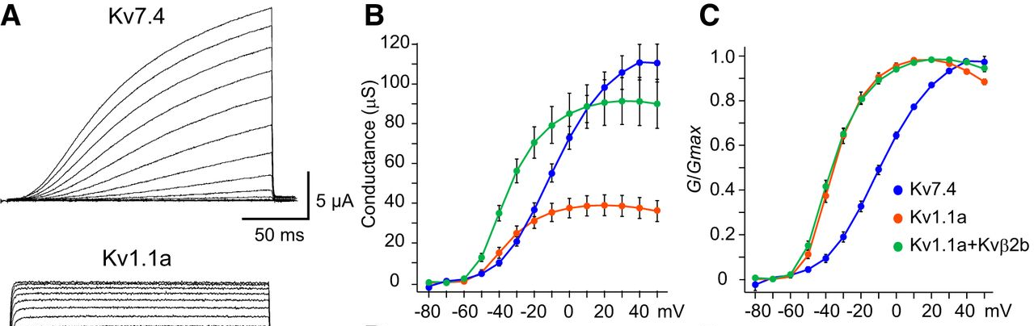
Kv7.4 opens slowly; Kvβ2 speeds up Kv1.1
Watanabe and colleagues expressed zebrafish Kv7.4 and Kv1.1 in Xenopus oocytes, frog eggs that can be injected with mRNA to make a single channel type, and recorded the currents at command voltages from −80 to +50 mV.
Both channels produced low-threshold outward currents, beginning to activate above about −60 mV. Kv7.4 rose slowly, taking tens of milliseconds to reach half its maximum, whereas Kv1.1 activated within a few milliseconds. Coexpressing Kvβ2 accelerated Kv1.1 activation and increased its current. Kv1.1 opened at more negative voltages than Kv7.4.
In computational models, Kv7.4 suppressed repetitive firing to produce adaptation, while Kvβ2-associated Kv1.1 raised the firing threshold and shortened the latency of the first spike. A fast Kv1 current that terminates firing right after the first spike, together with a slower Kv7 current that suppresses repetitive firing, accounts for the M-cell's single, short-latency spike.
Watanabe et al. (2017), Fig. 4A–C. Currents of Kv7.4, Kv1.1a and Kv1.1a+Kvβ2b in oocytes; conductance and normalized conductance versus voltage.
Watanabe et al. (2017)
32
Notes:
• To study the channels in isolation, the researchers injected their messenger RNA into frog oocytes, which then make only that channel.
– Both Kv7.4 and Kv1.1 started passing outward current at relatively negative voltages, above about minus 60 millivolts, which is why they are called low-threshold.
• They differed in speed.
– Kv7.4 turned on slowly, over tens of milliseconds.
– Kv1.1 turned on within a few milliseconds, and adding the Kvβ2 subunit made it faster still and larger.
• Computer models of the Mauthner cell put these roles together.
– Kv7.4 alone produced adapting bursts, the immature pattern.
– Adding the fast, Kvβ2-boosted Kv1.1 raised the threshold and moved the first spike earlier, giving one quick spike, the adult pattern.
References:
Watanabe T, Shimazaki T, Oda Y (2017). Coordinated expression of two types of low-threshold K+ channels establishes unique single spiking of Mauthner cells among segmentally homologous neurons in the zebrafish hindbrain. eNeuro 4(5): ENEURO.0249-17.2017. https://doi.org/10.1523/ENEURO.0249-17.2017
Figure: Watanabe et al. (2017), Fig. 4A–C. Currents of Kv7.4, Kv1.1a and Kv1.1a+Kvβ2b in oocytes; conductance and normalized conductance versus voltage.
Figure source: https://doi.org/10.1523/ENEURO.0249-17.2017

Slide 42
Low-threshold K+ currents tune the M-cell to onsets
Low-threshold potassium channels open near rest, so any depolarization starts an outward current that pulls the voltage back. A slowly rising input gives these channels time to open before threshold and is cancelled as it builds. A rapidly rising input outpaces them and fires a spike, after which the open channels prevent another.
The two channels divide this work by speed. Kv1.1 activates within milliseconds; blocking it with dendrotoxin lowered the current needed to fire mature M-cells and delayed their first spike, so the fast channel holds the cell back from weak, gradual input. Kv7.4 activates over tens of milliseconds and mainly suppresses the later, repeated spikes during a sustained input.
The result is a cell that reports sudden change, not steady strength. Otero-Coronel and colleagues reach the same view from integration experiments, calling the M-cell a sudden-stimulus detector. Intensity is left to the repetitively firing homologs, so the M-series reports both when a threat begins and how strong it is.
Watanabe et al. (2017), Fig. 4A–C. Currents of Kv7.4, Kv1.1a and Kv1.1a+Kvβ2b in oocytes; conductance and normalized conductance versus voltage.
Watanabe et al. (2017); Otero-Coronel et al. (2024)
32a
Notes:
• Slides 30 to 32 identify the channels that limit the M-cell to one spike; what that does to the cell's response to real stimuli follows from how low-threshold channels behave over time.
• Timing decides whether an input wins.
– Low-threshold potassium channels are already partly activated near the resting potential, and they open further as the membrane depolarizes.
– An input that rises slowly recruits this opposing current along the way, while a sudden input reaches threshold before the current has built up.
• The pharmacology separates the two channels' roles.
– In mature M-cells, dendrotoxin reduced threshold current and lengthened spike latency, whereas XE991 alone affected neither, according to Watanabe and colleagues.
– Combined with the slow kinetics of Kv7.4 in oocytes on slide 32, this assigns the immediate gatekeeping to Kv1.1 and the suppression of later spikes to Kv7.4.
• Function follows from the channel set.
– Otero-Coronel and colleagues, working on multisensory summation, saw a plateau in sustained depolarization and little effect of stimulus frequency, and concluded that the M-cell is a sudden-stimulus detector more than a coder of stimulus properties.
– Watanabe and colleagues assign the coding of sound intensity to MiD2cm and MiD3cm, whose firing rate grows with input, as slide 13 notes.
References:
Watanabe T, Shimazaki T, Oda Y (2017). Coordinated expression of two types of low-threshold K+ channels establishes unique single spiking of Mauthner cells among segmentally homologous neurons in the zebrafish hindbrain. eNeuro 4(5): ENEURO.0249-17.2017. https://doi.org/10.1523/ENEURO.0249-17.2017
Otero-Coronel S, Preuss T, Medan V (2024). Multisensory integration enhances audiovisual responses in the Mauthner cell. eLife 13: RP99424. https://doi.org/10.7554/eLife.99424

Slide 43
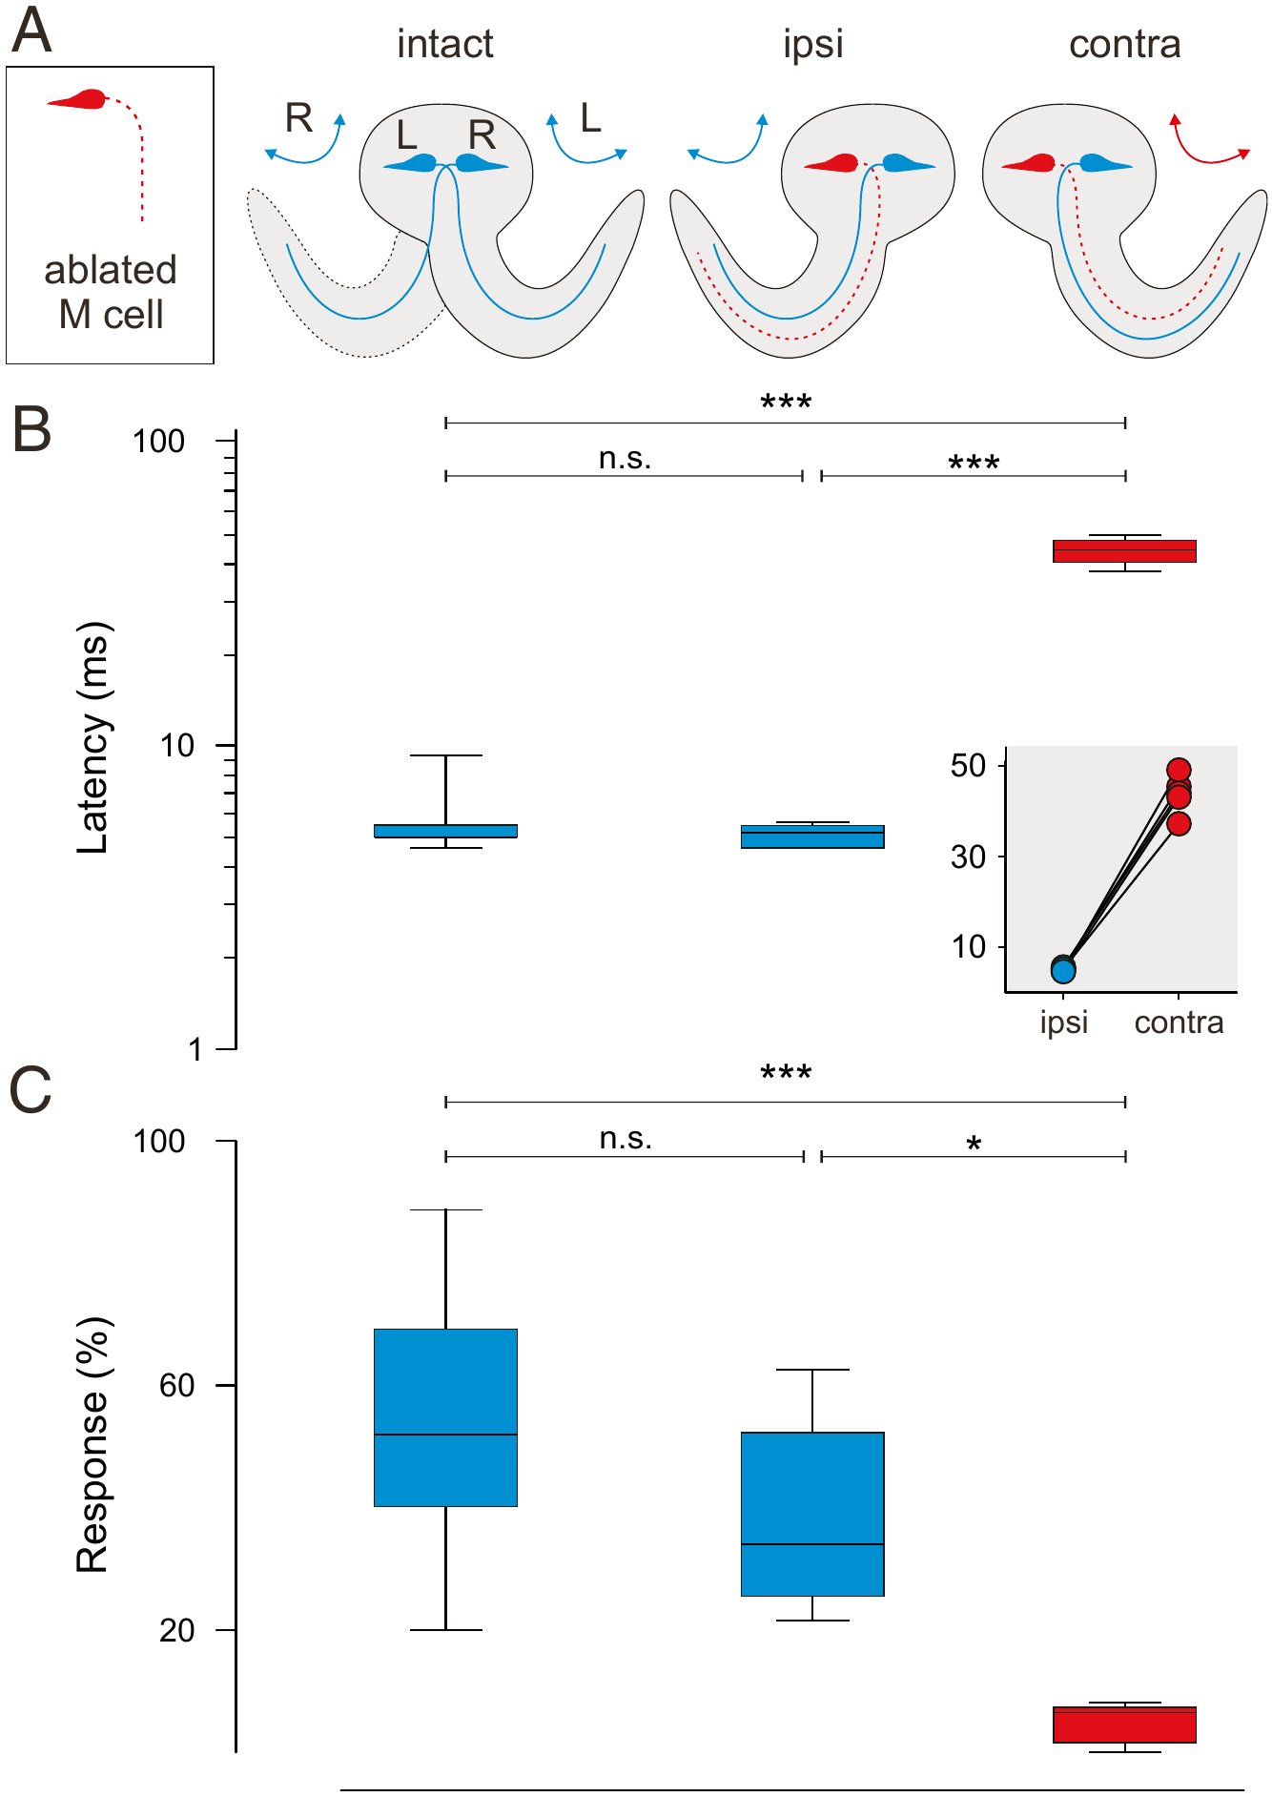
Removing one M axon removes fast escapes to one side
Earlier ablations of the M-cell soma did not abolish all rapid escapes, so it seemed that smaller neurons could compensate. Hecker and colleagues found that the giant axon survives for a long time after its soma is destroyed and can still drive escapes. They therefore removed both the soma and the axon of one M-cell, verified by two-photon imaging.
Each M-cell drives bends to the opposite side. Escapes that could still use the remaining M-cell ("ipsi") had normal latencies of about 5 ms and normal response probability. Escapes that would have required the ablated cell ("contra") had latencies around 40 ms and were rare.
Escapes toward the intact side did not differ from those of untreated larvae, so the ablation had no general side effect. The comparison within a single larva isolates the contribution of one identified neuron: without its M axon, a fish loses its fast escapes to one side.
Hecker et al. (2020), Fig. 1A–C. Unilateral M-cell ablation: escape latency and response probability for intact, ipsi (can recruit M) and contra escapes.
Hecker et al. (2020)
33
Notes:
• Earlier experiments had killed the Mauthner cell body and still seen fast escapes, so it was thought other neurons could take over.
– Hecker and colleagues found the reason: the giant axon survives long after the soma is destroyed and keeps working.
– They removed both the soma and the axon of one Mauthner cell and confirmed it with two-photon imaging.
• Because each Mauthner cell bends the body toward the opposite side, every larva became its own control.
– Escapes that could still use the intact Mauthner cell had normal latencies of about 5 milliseconds and normal probability.
– Escapes that needed the missing cell were rare and started only after about 40 milliseconds.
• Escapes toward the intact side were just like those of untreated siblings, so the procedure itself caused no general damage. Without its giant axon, the fish loses fast escapes to one side.
References:
Hecker A, Schulze W, Oster J, Richter DO, Schuster S (2020). Removing a single neuron in a vertebrate brain forever abolishes an essential behavior. Proceedings of the National Academy of Sciences USA 117(6): 3254–3260. https://doi.org/10.1073/pnas.1918578117
Figure: Hecker et al. (2020), Fig. 1A–C. Unilateral M-cell ablation: escape latency and response probability for intact, ipsi (can recruit M) and contra escapes.
Figure source: https://doi.org/10.1073/pnas.1918578117

Slide 44
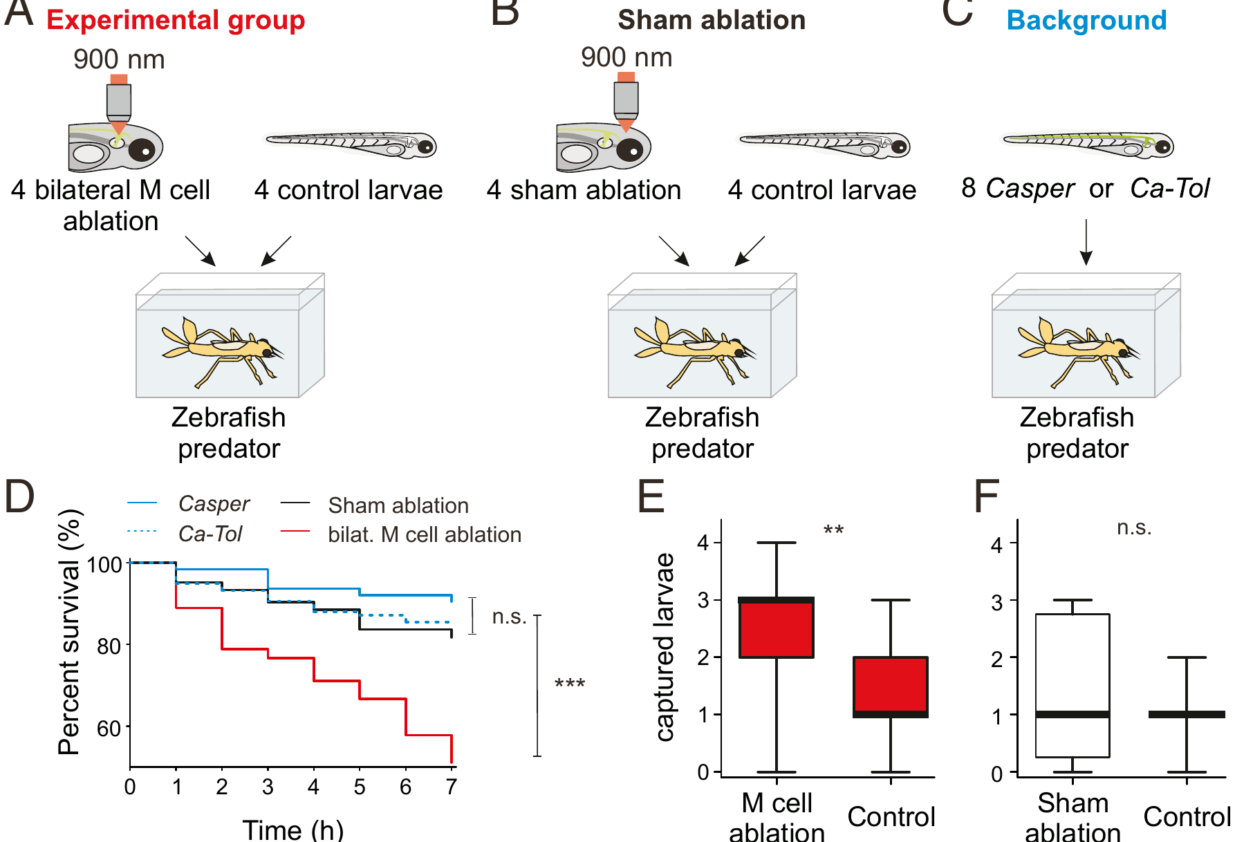
Larvae without M axons are caught more often by predators
Hecker and colleagues asked whether M-cell escapes improve survival. Groups of eight larvae were placed with a last-instar damselfly nymph, a natural predator of zebrafish larvae.
In each experimental group, four larvae had both M axons removed and four were untreated. In procedural controls, four larvae received sham ablations of two cerebellar neurons and four were untreated. Additional groups contained only untreated larvae of the two strains used.
Over 7 hours, the survival of M-ablated larvae dropped steeply compared with sham-ablated and untreated larvae, and the M-ablated larvae were captured more often than their untreated tank-mates. Sham-ablated larvae were captured no more often than controls, and the control groups did not differ from one another. The loss of a single pair of neurons was enough to make the fish more vulnerable to an ecologically relevant predator.
Hecker et al. (2020), Fig. 3A–F. Predation assays with damselfly nymphs: survival over 7 h and captured larvae for M-ablated and sham groups.
Hecker et al. (2020)
34
Notes:
• The survival test put larvae in a tank with a damselfly nymph, a predator that eats zebrafish larvae in the wild.
– Each tank held eight larvae: four with both Mauthner axons removed and four untreated.
• The controls addressed the obvious alternatives.
– In some tanks, four larvae had a sham ablation of two cerebellar neurons, to test whether laser surgery itself made fish easier to catch.
– Other tanks held only untreated larvae of the two strains used.
• Over seven hours, Mauthner-ablated larvae were lost much faster than sham-ablated or untreated larvae.
– At the end, the ablated larvae had been eaten more often than their untreated tank-mates, while sham-ablated larvae were eaten no more than controls.
– One pair of neurons measurably changed the outcome of real predator encounters.
References:
Hecker A, Schulze W, Oster J, Richter DO, Schuster S (2020). Removing a single neuron in a vertebrate brain forever abolishes an essential behavior. Proceedings of the National Academy of Sciences USA 117(6): 3254–3260. https://doi.org/10.1073/pnas.1918578117
Figure: Hecker et al. (2020), Fig. 3A–F. Predation assays with damselfly nymphs: survival over 7 h and captured larvae for M-ablated and sham groups.
Figure source: https://doi.org/10.1073/pnas.1918578117

Slide 45
Mixed tanks turn a predator into a direct test of one neuron
The assay was built so that any difference had to come from the missing neurons. Each nymph hunted ablated and untreated larvae in one tank, so predator and conditions were shared, and nymphs were fed on one schedule beforehand to equalize hunger. Sham larvae got the same laser energy, aimed at two cerebellar neurons.
Genetic labels made the count possible: ablated larvae came from a strain with green fluorescent eyes and their tank-mates were unpigmented casper larvae, so survivors of each kind could be counted after 7 hours. Untreated groups of each strain checked that the strains survived equally.
The result settles a long-standing argument. Some had argued that about 4 ms of latency moves a fish only a few millimeters and should not affect survival. Against a damselfly nymph's targeted, ballistic strike, losing the fastest escapes cost lives, giving one identified pair of neurons a measurable survival value.
Hecker et al. (2020), Fig. 3A–F. Predation assays with damselfly nymphs: survival over 7 h and captured larvae for M-ablated and sham groups.
Hecker et al. (2020)
34a
Notes:
• Slide 34 reports that M-ablated larvae were eaten more often; the assay's design is what allows that difference to be attributed to the M-cells.
• Sharing a tank removes predator variability.
– Individual nymphs differ in size and appetite, so comparing separate tanks would confound larval ability with predator behavior.
– Placing four ablated and four untreated larvae with the same nymph means that every strike opportunity is shared, and Hecker and colleagues kept nymphs on a common feeding regime during a preparation phase.
• Each control removes one alternative explanation.
– The cerebellar sham ablation used the identical laser procedure, so damage from the surgery itself is excluded.
– The ablated larvae were also checked before the assay for complete loss of both soma and initial segment, the requirement established on slides 24 and 33.
• The test answers an old doubt about giant neurons.
– Earlier authors argued that a few milliseconds of latency change hardly displaces a fish, and some field studies had found no survival advantage of rapid escapes.
– Damselfly nymphs strike ballistically at close range, the situation in which milliseconds decide the outcome, and against them the loss of the M-cells was costly.
References:
Hecker A, Schulze W, Oster J, Richter DO, Schuster S (2020). Removing a single neuron in a vertebrate brain forever abolishes an essential behavior. Proceedings of the National Academy of Sciences USA 117(6): 3254–3260. https://doi.org/10.1073/pnas.1918578117

Slide 46
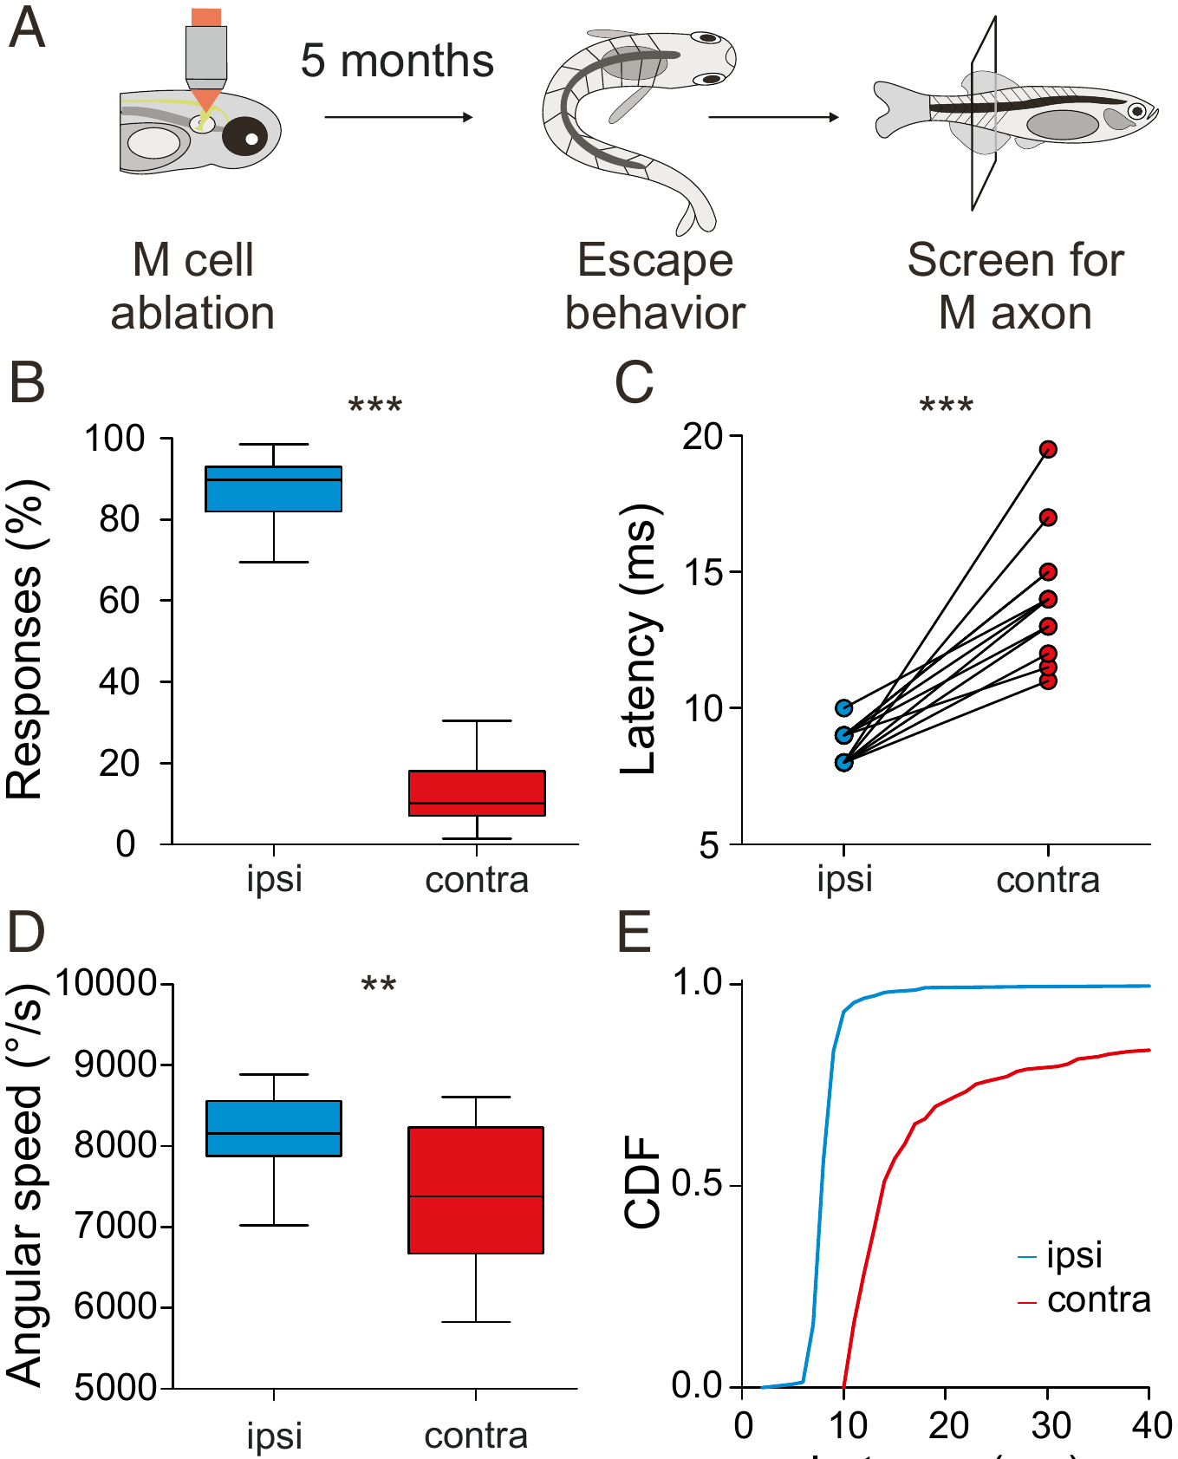
An M axon lost early is never replaced
Larvae with one M axon removed were raised with untreated siblings for 5 months. Their escapes were then tested blind, after which each fish was examined to determine which M axon, if any, was missing.
As adults, the fish still escaped predominantly toward the side that could use the remaining M-cell. Escapes that could not recruit an M axon had longer latencies and lower angular speeds than escapes by the same fish that could, so the deficit had not been compensated during growth.
Schuster summarizes the result: across the months of development no other neuron took over the function of the missing M-cell. Hecker and colleagues proposed that mechanisms must exist to keep this single, survival-critical axon alive and connected, which could account for how long the axon survives after its soma is lost.
Hecker et al. (2020), Fig. 4A–E. Adults 5 months after unilateral M-axon ablation: responses, latency and angular speed for ipsi and contra escapes.
Hecker et al. (2020); Schuster (2023)
35
Notes:
• The last experiment asked whether the brain makes up for a missing Mauthner cell over time.
– Larvae with one Mauthner axon removed grew up for five months with their untreated siblings.
• The adults were tested without the experimenters knowing which fish had been ablated.
– The fish still escaped mostly toward the side served by the remaining Mauthner cell.
– In the same fish, escapes that could not use a Mauthner axon started later and turned more slowly, so the deficit was still present in adulthood.
• No other neuron took over during five months of growth. Hecker and colleagues proposed that, because so much depends on this one axon, mechanisms must exist to keep it alive and connected, consistent with how long it survives after injury.
References:
Hecker A, Schulze W, Oster J, Richter DO, Schuster S (2020). Removing a single neuron in a vertebrate brain forever abolishes an essential behavior. Proceedings of the National Academy of Sciences USA 117(6): 3254–3260. https://doi.org/10.1073/pnas.1918578117
Schuster S (2023). The archerfish predictive C-start. Journal of Comparative Physiology A 209(5): 827–837. https://doi.org/10.1007/s00359-023-01658-2
Figure: Hecker et al. (2020), Fig. 4A–E. Adults 5 months after unilateral M-axon ablation: responses, latency and angular speed for ipsi and contra escapes.
Figure source: https://doi.org/10.1073/pnas.1918578117

Slide 47
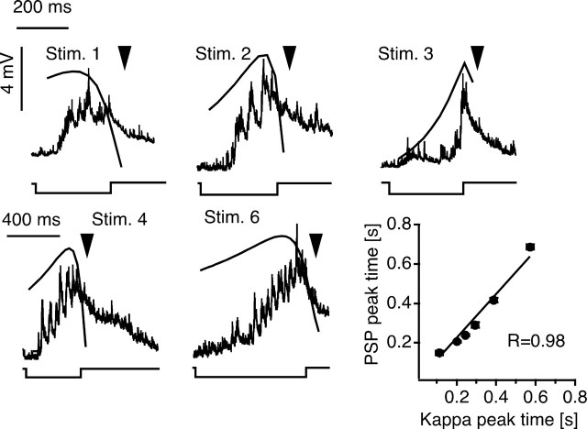
Looming objects drive M-cell escapes in goldfish
Preuss and colleagues projected expanding dark disks above goldfish to simulate an approaching object, a looming stimulus. These stimuli evoked C-starts with probabilities of 0.7–0.91 and mean latencies from 142 to 716 ms, and chronic recordings linked the C-starts to M-cell spikes.
Intracellular recordings from the M-cell revealed bursts of graded EPSPs that grew as the disk expanded, with peaks of up to 9 mV. The depolarizing envelope followed a scaled function of the disk's angular size, the angle it subtended at the eye, in which the weight of angular size progressively decreased as the image grew. The timing of the largest PSP peak was predicted by the peak of that function.
A receding disk evoked much weaker responses than the same disk looming, so the M-cell response was specific to approach. Recordings of presynaptic inhibitory interneurons suggested that the timing of the PSP peak is shaped by the interplay of visual excitation and feedforward inhibition.
Preuss et al. (2006), Fig. 5. M-cell PSPs evoked by looming stimuli with the superimposed scaling function κ(t); PSP peak time versus κ peak time.
Preuss et al. (2006)
36
Notes:
• Preuss and colleagues imitated an approaching predator with a dark disk that expanded on a screen above the fish.
– Most presentations, 70 to 91 percent, triggered a C-start, after delays of about 140 to 720 milliseconds depending on the stimulus, much longer than the auditory startle.
• Inside the Mauthner cell, the visual input arrived as a growing barrage of small excitatory potentials.
– The envelope of that depolarization followed a function of the disk's angular size, the angle it covers on the retina, in which each increase in size counts for less as the disk gets larger.
– The time of the biggest potential matched the peak of that function very closely.
• A disk moving away produced much weaker responses, so the Mauthner cell responded specifically to approach.
– Recordings from inhibitory interneurons suggested that inhibition from the visual pathway shapes when the depolarization peaks.
References:
Preuss T, Osei-Bonsu PE, Weiss SA, Wang C, Faber DS (2006). Neural representation of object approach in a decision-making motor circuit. Journal of Neuroscience 26(13): 3454–3464. https://doi.org/10.1523/JNEUROSCI.5259-05.2006
Figure: Preuss et al. (2006), Fig. 5. M-cell PSPs evoked by looming stimuli with the superimposed scaling function κ(t); PSP peak time versus κ peak time.
Figure source: https://doi.org/10.1523/JNEUROSCI.5259-05.2006

Slide 48
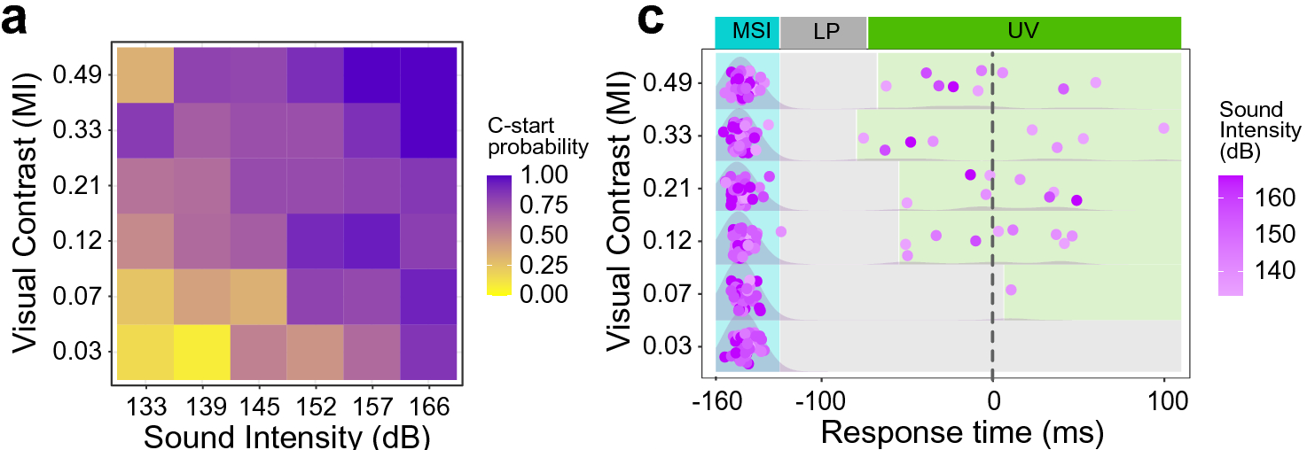
Sound and looming combine to make escape more likely
Martorell and Medan presented goldfish with a visual loom, a brief sound, or both, with the sound arriving 160 ms before the end of the loom. Multisensory integration is the combination of information from different senses into a single response.
Combined stimuli increased C-start probability above that produced by either stimulus alone. The enhancement was inversely related to stimulus salience: weak sounds produced a proportionally larger multisensory effect than strong ones. Fish that were freezing before the stimulus responded less, so the animal's prior motor state also influenced the decision.
Multisensory stimulation also shortened response times, and most escapes were locked to the auditory cue, occurring within a short window after it. An integrate-and-fire model of the M-cell, which sums inputs until a threshold is reached, reproduced the behavior, suggesting that excitatory visual and auditory inputs summed at the M-cell soma underlie the multisensory decision.
Martorell & Medan (2022), Fig. 4a,c. C-start probability across visual contrast and sound intensity (a); response times, colored by sound intensity (c).
Martorell & Medan (2022)
37
Notes:
• Martorell and Medan asked how the fish combines a looming shape with a sound.
– Goldfish saw a loom, heard a brief sound, or got both, with the sound coming 160 milliseconds before the loom finished expanding.
• The combination was more effective than either stimulus alone.
– The boost was largest when the stimuli were weak; a faint sound added proportionally more than a loud one.
– Fish that were already freezing responded less, so the fish's prior state also mattered.
• Combined stimuli also made the escape happen sooner, with most escapes following the sound within a short window.
– A simple model of the Mauthner cell, which adds up inputs until it reaches threshold, reproduced these results, suggesting the two senses are summed on the Mauthner cell itself.
References:
Martorell N, Medan V (2022). Audiovisual integration in the Mauthner cell enhances escape probability and reduces response latency. Scientific Reports 12: 1097. https://doi.org/10.1038/s41598-022-04998-2
Figure: Martorell & Medan (2022), Fig. 4a,c. C-start probability across visual contrast and sound intensity (a); response times, colored by sound intensity (c).
Figure source: https://doi.org/10.1038/s41598-022-04998-2

Slide 49
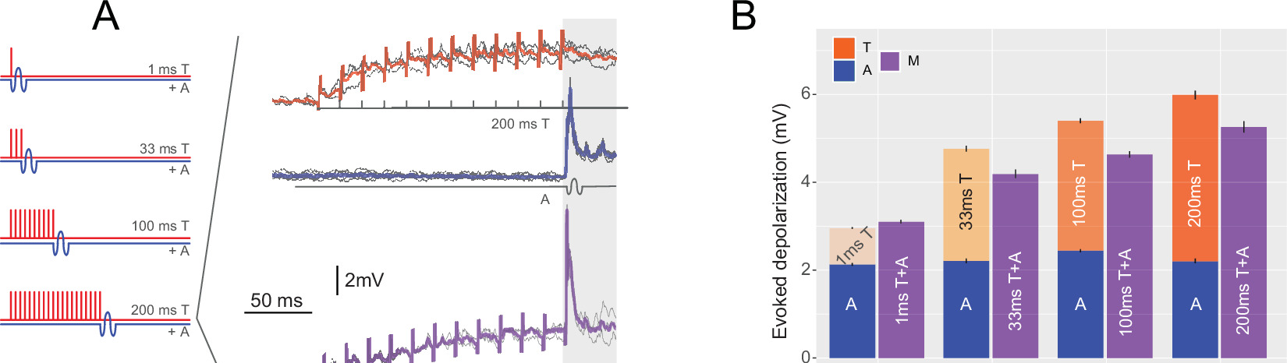
The M-cell sums auditory and tectal inputs sublinearly
Otero-Coronel and colleagues recorded M-cells intracellularly in adult goldfish while stimulating the optic tectum electrically (T) and presenting a sound pip (A), separately and together. Tectal trains of 1–200 ms evoked depolarizations that grew with duration.
The combined multisensory response (M) was larger than the largest response to either input alone, but for trains longer than 1 ms it was smaller than the sum of the two. The integration is therefore sublinear. Stimulus modality, intensity, temporal structure and the delay between stimuli all affected how inputs summed.
The different decay of auditory and tectal feedforward inhibition accounted for some of these effects: the faster-fading tectal inhibition allows a later auditory input to sum more effectively. The M-cell is a rare case in which multisensory integration can be measured in a neuron whose firing directly triggers a behavior.
Otero-Coronel et al. (2024), Fig. 2A–B. M-cell responses to tectal trains (T), sound (A) and both (M); stacked bars compare unisensory and multisensory depolarization.
Otero-Coronel et al. (2024); Martorell & Medan (2022)
38
Notes:
• Otero-Coronel and colleagues recorded inside the Mauthner cell of adult goldfish while stimulating vision and hearing.
– They stimulated the optic tectum electrically, as a stand-in for visual input, and played a short sound.
• Together, the two inputs depolarized the cell more than either one alone.
– But for most combinations the response was less than the two separate responses added together, which is called sublinear summation.
– How the inputs combined depended on modality, intensity, timing and the delay between them.
• Feedforward inhibition helps explain the pattern. Inhibition triggered by the tectum fades faster than inhibition triggered by sound, which changes how much the second input can add. Because one spike in this cell starts an escape, its integration of the two senses directly determines behavior.
References:
Otero-Coronel S, Preuss T, Medan V (2024). Multisensory integration enhances audiovisual responses in the Mauthner cell. eLife 13: RP99424. https://doi.org/10.7554/eLife.99424
Martorell N, Medan V (2022). Audiovisual integration in the Mauthner cell enhances escape probability and reduces response latency. Scientific Reports 12: 1097. https://doi.org/10.1038/s41598-022-04998-2
Figure: Otero-Coronel et al. (2024), Fig. 2A–B. M-cell responses to tectal trains (T), sound (A) and both (M); stacked bars compare unisensory and multisensory depolarization.
Figure source: https://doi.org/10.7554/eLife.99424

Slide 50
Sublinear summation still raises the odds of firing
A C-start depends on whether the M-cell crosses threshold, not on how large its depolarization is. A combined response smaller than the sum of its parts can still cross threshold when neither input does alone. Otero-Coronel and colleagues found that a preceding tectal input enlarged the response to a sound pip by about 50%.
Inverse effectiveness, the larger relative gain from combining weak stimuli, has a direct cellular counterpart. When both unisensory responses were small, below about 2.5 mV, the combined response was supralinear and 50–100% larger than the best single input; with stronger inputs, summation became sublinear. Weak, ambiguous cues gain the most from a second sense.
This tuning matches the fish's needs. A strong sound or a fast loom triggers an escape on its own, so a second sense adds little; a faint sound paired with a dim loom, each unlikely to succeed alone, gains the most. Freezing fish, which escaped less to every stimulus, start further from that threshold.
Otero-Coronel et al. (2024), Fig. 2A–B. M-cell responses to tectal trains (T), sound (A) and both (M); stacked bars compare unisensory and multisensory depolarization.
Otero-Coronel et al. (2024); Martorell & Medan (2022)
38a
Notes:
• Slides 37 and 38 can look contradictory: behavior shows strong multisensory enhancement, yet the M-cell sums its inputs sublinearly. The two fit together because the behavior depends on a threshold.
• Threshold turns small voltage gains into large probability gains.
– If an auditory input alone leaves the cell just below threshold, any added visual depolarization, even one smaller than the visual response alone, can produce the spike.
– Otero-Coronel and colleagues measured an enhancement of roughly half over the best single input, which is substantial near threshold whatever the arithmetic sum would be.
• The cellular data reproduce inverse effectiveness.
– Pooling all their stimulus combinations, the authors found that the relative multisensory gain fell as unisensory responses grew.
– Martorell and Medan had found the same relationship in behavior on slide 37, with faint sounds adding proportionally more.
• The animal's state shifts the starting point.
– Martorell and Medan found that freezing fish performed C-starts far less often than fish that were swimming or beating their fins.
– In threshold terms, that is consistent with a resting M-cell that needs more combined input before it fires.
References:
Otero-Coronel S, Preuss T, Medan V (2024). Multisensory integration enhances audiovisual responses in the Mauthner cell. eLife 13: RP99424. https://doi.org/10.7554/eLife.99424
Martorell N, Medan V (2022). Audiovisual integration in the Mauthner cell enhances escape probability and reduces response latency. Scientific Reports 12: 1097. https://doi.org/10.1038/s41598-022-04998-2

Slide 51
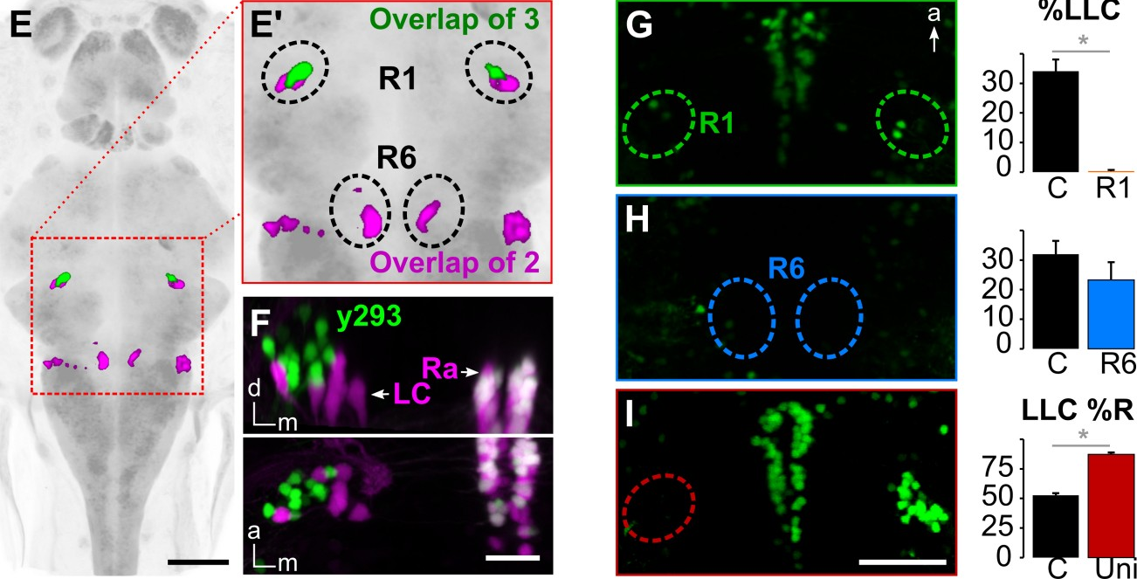
Delayed escapes use a separate prepontine pathway
Marquart and colleagues searched for the neurons that drive long-latency C-bends. They expressed a nitroreductase enzyme in neurons labeled by 28 different Gal4 lines, then added metronidazole, which nitroreductase converts into a toxin, to kill only the labeled cells.
Ablation in three lines reduced LLCs by more than half. Their expression overlapped in a small bilateral cluster in rhombomere 1 of the prepontine hindbrain (R1), near the locus coeruleus and raphe. Laser ablation of R1 abolished LLCs, whereas ablating a cluster in rhombomere 6 (R6) did not.
After ablating R1 on the left only, most remaining LLCs went to the right, so each prepontine cluster drives escapes toward its own side. These prepontine neurons, a cluster of 38 cells, are completely separate from the M-cell and its homologs. Escapes with long latency use a different command pathway rather than a slow version of the Mauthner pathway.
Marquart et al. (2019), Fig. 2E–I. Overlap of three Gal4 lines in prepontine cluster R1; LLC probability after laser ablation of R1, R6 or left R1.
Marquart et al. (2019)
39
Notes:
• Marquart and colleagues did a circuit-breaking screen to find the neurons behind long-latency escapes.
– In each of 28 genetic lines, a set of neurons made nitroreductase, an enzyme that turns the drug metronidazole into a toxin, so adding the drug killed just those neurons.
• Three lines lost more than half of their long-latency escapes after ablation.
– Their labeled neurons overlapped in a small cluster on each side of rhombomere 1, in the prepontine hindbrain near the locus coeruleus and raphe.
– Killing that cluster with a laser abolished long-latency escapes, while killing a cluster in rhombomere 6 did not.
• Ablating the left cluster alone sent most remaining long-latency escapes to the right.
– These 38 prepontine neurons are entirely separate from the Mauthner cells, so the delayed escape uses its own command pathway.
References:
Marquart GD, Tabor KM, Bergeron SA, Briggman KL, Burgess HA (2019). Prepontine non-giant neurons drive flexible escape behavior in zebrafish. PLoS Biology 17(10): e3000480. https://doi.org/10.1371/journal.pbio.3000480
Figure: Marquart et al. (2019), Fig. 2E–I. Overlap of three Gal4 lines in prepontine cluster R1; LLC probability after laser ablation of R1, R6 or left R1.
Figure source: https://doi.org/10.1371/journal.pbio.3000480

Slide 52
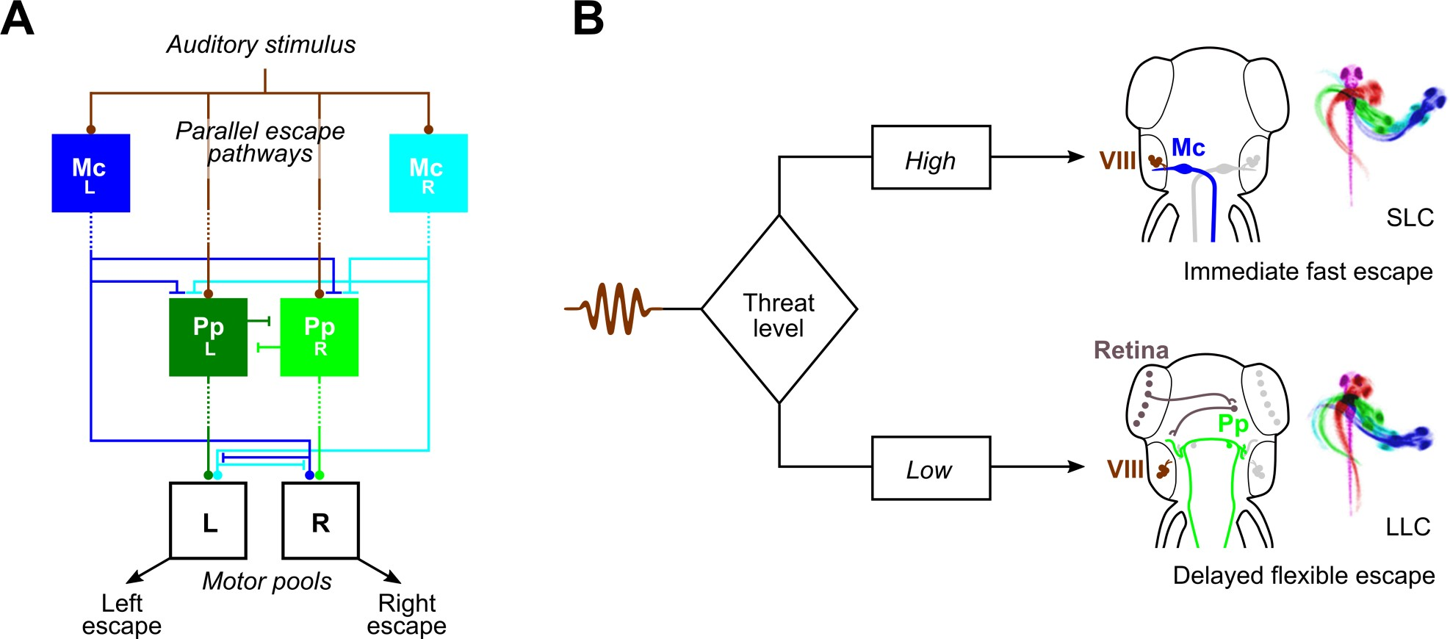
Threat level selects between parallel escape pathways
Marquart and colleagues proposed that zebrafish choose between two parallel escape pathways. Auditory input reaches the M-cells directly, and the M-cells drive motoneurons directly. The prepontine neurons receive auditory information only indirectly and drive the spinal cord indirectly. An M-cell that fires first can therefore prevent a delayed escape, and the M-cells inhibit the prepontine neurons.
A high threat level triggers the immediate, ballistic M-cell escape. A lower threat level allows a delayed, flexible escape whose trajectory can be guided by visual information.
Visual threats are assessed the same way. Bhattacharyya and colleagues found that slowly approaching looms evoked slower, longer-latency, more variable escapes, whereas fast looms evoked short-latency escapes with M-cell activity, and all escapes began at the same angular size. Dunn and colleagues showed that the optic tectum processes looming stimuli and that visual and mechanosensory escapes share the same hindbrain premotor network.
Marquart et al. (2019), Fig. 7A–B. Parallel escape pathways through M-cells (Mc) and prepontine neurons (Pp), selected according to threat level.
Marquart et al. (2019); Bhattacharyya et al. (2017); Dunn et al. (2016)
40
Notes:
• Marquart's model has two escape routes running in parallel.
– Sound reaches the Mauthner cells directly, and the Mauthner cells drive motoneurons directly, so this route is fastest.
– The prepontine neurons get auditory information only through intermediate steps and also reach the spinal cord indirectly, so they are slower but can combine more information, including vision.
• When the threat is high, the Mauthner cell fires first and its escape preempts the other route. When the threat is lower, the delayed prepontine escape occurs, and its direction can be steered.
• Visual threats follow the same logic.
– Bhattacharyya and colleagues found that slow looms produced slower, later and more variable escapes, while fast looms produced quick escapes with Mauthner cell activity, and all of them began when the object reached the same apparent size.
– Dunn and colleagues showed that the optic tectum processes the looming signal and that vision feeds into the same hindbrain escape network as touch and sound.
References:
Marquart GD, Tabor KM, Bergeron SA, Briggman KL, Burgess HA (2019). Prepontine non-giant neurons drive flexible escape behavior in zebrafish. PLoS Biology 17(10): e3000480. https://doi.org/10.1371/journal.pbio.3000480
Bhattacharyya K, McLean DL, MacIver MA (2017). Visual threat assessment and reticulospinal encoding of calibrated responses in larval zebrafish. Current Biology 27(18): 2751–2762.e6. https://doi.org/10.1016/j.cub.2017.08.012
Dunn TW, Gebhardt C, Naumann EA, Riegler C, Ahrens MB, Engert F, Del Bene F (2016). Neural circuits underlying visually evoked escapes in larval zebrafish. Neuron 89(3): 613–628. https://doi.org/10.1016/j.neuron.2015.12.021
Figure: Marquart et al. (2019), Fig. 7A–B. Parallel escape pathways through M-cells (Mc) and prepontine neurons (Pp), selected according to threat level.
Figure source: https://doi.org/10.1371/journal.pbio.3000480

Slide 53
Indirect routes trade speed for time to use more information
Every added relay costs time but offers a point where other signals can join. The Mauthner route has almost none, so it fires before visual or contextual information can be consulted. Prepontine neurons receive sound only through intermediate neurons and reach the spinal cord through a caudal hindbrain neuropil, consistent with escapes that begin 16–50 ms after the stimulus.
The extra time is used. With a light spot present before a nondirectional sound, long-latency escapes turned toward the spot while short-latency escapes did not, and the bias vanished in atoh7 mutants, which lack retinal projections to the brain. Visual information about the surroundings enters the delayed pathway but not the Mauthner pathway.
Timing also arbitrates between them. A strong stimulus fires the M-cell within milliseconds and its escape preempts the slower route; a weaker one leaves time for the prepontine command. A lower M-cell threshold shifts the balance: ZO1b mutants, with more excitable M-cells, startled more at mid-range intensities and almost lost their long-latency escapes.
Marquart et al. (2019), Fig. 7A–B. Parallel escape pathways through M-cells (Mc) and prepontine neurons (Pp), selected according to threat level.
Marquart et al. (2019); Lasseigne et al. (2021)
40a
Notes:
• Slides 7, 8, 39 and 40 describe two escapes that differ in latency and flexibility; the anatomy of the two pathways explains why the slower one is the flexible one.
• Relays cost time and add opportunity.
– Marquart and colleagues reconstructed prepontine neurons and found that they project to a dense neuropil in the caudal hindbrain rather than into the spinal cord, so they must act through further premotor cells.
– Their auditory input is likewise polysynaptic, possibly arriving through the eminentia granularis, where their neurites resemble dendrites.
• A light-spot experiment showed what the extra time buys.
– Larvae are attracted to light, and when a spot was shown before a nondirectional sound, long-latency escapes were preferentially directed toward it.
– Short-latency escapes ignored the spot, and mutants without retinal projections lost the bias, so the steering signal is visual.
• Changing M-cell excitability tips the competition.
– Marquart's model gives the M-cells two ways to win: their escape starts first, and they inhibit the prepontine neurons.
– The ZO1b mutants on slides 20 and 21 fit this: higher M-cell input resistance meant more startles at intermediate intensities and long-latency escapes nearly disappeared.
References:
Marquart GD, Tabor KM, Bergeron SA, Briggman KL, Burgess HA (2019). Prepontine non-giant neurons drive flexible escape behavior in zebrafish. PLoS Biology 17(10): e3000480. https://doi.org/10.1371/journal.pbio.3000480
Lasseigne AM, Echeverry FA, Ijaz S, Michel JC, Martin EA, Marsh AJ, Trujillo E, Marsden KC, Pereda AE, Miller AC (2021). Electrical synaptic transmission requires a postsynaptic scaffolding protein. eLife 10: e66898. https://doi.org/10.7554/eLife.66898

Slide 54
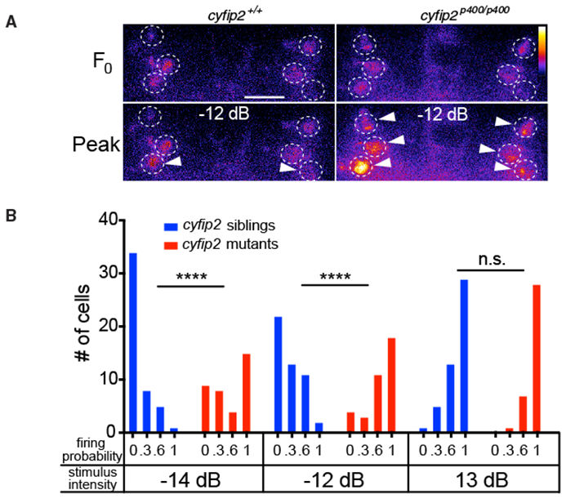
Spiral fiber activity sets the innate startle threshold
Marsden and colleagues screened for mutant larvae that startled to stimuli too weak to affect wild-type fish, and isolated five lines with reduced startle thresholds. In one line the mutation was in cyfip2, a gene encoding a protein that interacts with the fragile X protein FMRP; cyfip2 acted independently of FMRP.
Club-ending input to the M-cell was normal in cyfip2 mutants. The spiral fiber neurons, however, responded more strongly: imaged with a calcium indicator, they fired to weak and medium stimuli that rarely activated them in siblings, whereas strong stimuli activated them fully in both.
Restoring cyfip2 expression with a heat-inducible transgene after the phenotype had appeared returned startle sensitivity to baseline. The innate threshold of the startle is therefore set, at least in part, by limiting how readily the excitatory spiral fiber neurons respond, a pathway that Lacoste and colleagues showed is essential for M-cell escapes.
Marsden et al. (2018), Fig. 5A–B. Spiral fiber calcium responses to a −12 dB stimulus (A) and firing probability across intensities in siblings and cyfip2 mutants (B).
Marsden et al. (2018); Lacoste et al. (2015)
41
Notes:
• Marsden and colleagues looked for mutant larvae that startle too easily.
– They found five lines, and in one of them the mutation was in cyfip2, a gene whose protein binds the fragile X protein FMRP, although here it worked independently of FMRP.
• The defect was not in the main auditory input.
– Club-ending synapses onto the Mauthner cell worked normally in the mutants.
– Instead, the spiral fiber neurons were overactive: with calcium imaging they fired to weak sounds that rarely activated them in normal siblings, while loud sounds activated them fully in both.
• Turning cyfip2 back on with a heat-inducible transgene, even after the problem had appeared, restored normal startle sensitivity.
– The startle threshold is set partly by how easily the spiral fiber neurons, an essential excitatory input to the Mauthner cell, respond.
References:
Marsden KC, Jain RA, Wolman MA, Echeverry FA, Nelson JC, Hayer KE, Miltenberg B, Pereda AE, Granato M (2018). A Cyfip2-dependent excitatory interneuron pathway establishes the innate startle threshold. Cell Reports 23(3): 878–887. https://doi.org/10.1016/j.celrep.2018.03.095
Lacoste AM, Schoppik D, Robson DN, Haesemeyer M, Portugues R, Li JM, Randlett O, Wee CL, Engert F, Schier AF (2015). A convergent and essential interneuron pathway for Mauthner-cell-mediated escapes. Current Biology 25(11): 1526–1534. https://doi.org/10.1016/j.cub.2015.04.025
Figure: Marsden et al. (2018), Fig. 5A–B. Spiral fiber calcium responses to a −12 dB stimulus (A) and firing probability across intensities in siblings and cyfip2 mutants (B).
Figure source: https://doi.org/10.1016/j.celrep.2018.03.095

Slide 55
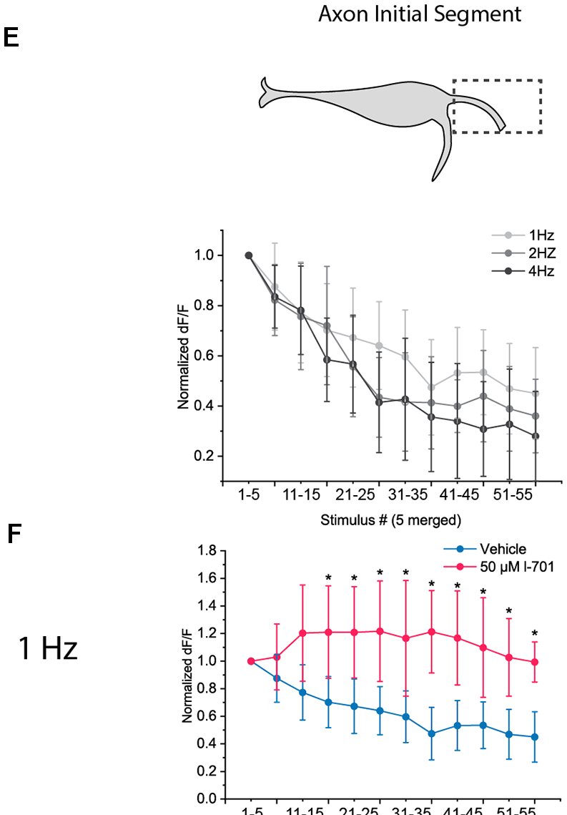
Habituation depresses excitation at the M-cell
Habituation is a decrease in response to a stimulus that is repeated without consequence. Roberts and colleagues found two forms of startle habituation in larvae: a rapid form lasting under 15 minutes after 120 pulses at 0.5–2 Hz, and a short-term form lasting up to an hour after spaced training, which alone required NMDA receptors.
Marsden and Granato imaged calcium in the M-cell of head-restrained larvae. The amplitude of the lateral-dendrite calcium signal determined startle probability, and habituation depressed this dendritic activity rather than acting downstream. It depended on glycine and NMDA receptors.
Bátora and colleagues found that glutamate release at both input sites declined during 60 repeated stimuli, and only at the axon initial segment did this depression depend on NMDA receptors. Pantoja and colleagues found that serotonergic neurons of the dorsal raphe, activated by the same stimuli, decrease their activity during habituation; reducing serotonin increased habituation.
Bátora et al. (2021), Fig. 4E–F. AIS glutamate release over 60 stimuli at 1–4 Hz (E); at 1 Hz with vehicle or the NMDA antagonist L-701,324 (F).
Bátora et al. (2021); Marsden & Granato (2015); Roberts et al. (2011)
42
Notes:
• Habituation is a drop in response to a stimulus that keeps repeating without consequence.
– Roberts and colleagues found two forms of startle habituation in larvae: a rapid one that faded within 15 minutes, and a longer one, produced by spaced blocks of stimuli, that lasted up to an hour and alone needed NMDA receptors.
• Marsden and Granato located the change in the Mauthner cell itself.
– The size of the calcium signal in the lateral dendrite predicted whether a startle occurred, and repeated stimuli made that signal smaller.
– This depression needed glycine and NMDA receptors, consistent with more inhibition from feedforward neurons and less excitation from the auditory afferents.
• Bátora and colleagues saw glutamate release fall at both input sites during repeated stimulation, with only the initial-segment depression depending on NMDA receptors.
– Pantoja and colleagues added a modulatory layer: serotonergic neurons in the dorsal raphe respond to the same sounds, their activity falls during habituation, and less serotonin means faster habituation.
References:
Bátora D, Zsigmond Á, Lőrincz IZ, Szegvári G, Varga M, Málnási-Csizmadia A (2021). Subcellular dissection of a simple neural circuit: functional domains of the Mauthner-cell during habituation. Frontiers in Neural Circuits 15: 648487. https://doi.org/10.3389/fncir.2021.648487
Marsden KC, Granato M (2015). In vivo Ca2+ imaging reveals that decreased dendritic excitability drives startle habituation. Cell Reports 13(9): 1733–1740. https://doi.org/10.1016/j.celrep.2015.10.060
Roberts AC, Reichl J, Song MY, Dearinger AD, Moridzadeh N, Lu ED, Pearce K, Esdin J, Glanzman DL (2011). Habituation of the C-start response in larval zebrafish exhibits several distinct phases and sensitivity to NMDA receptor blockade. PLoS ONE 6(12): e29132. https://doi.org/10.1371/journal.pone.0029132
Pantoja C, Hoagland A, Carroll EC, Karalis V, Conner A, Isacoff EY (2016). Neuromodulatory regulation of behavioral individuality in zebrafish. Neuron 91(3): 587–601. https://doi.org/10.1016/j.neuron.2016.06.016
Figure: Bátora et al. (2021), Fig. 4E–F. AIS glutamate release over 60 stimuli at 1–4 Hz (E); at 1 Hz with vehicle or the NMDA antagonist L-701,324 (F).
Figure source: https://doi.org/10.3389/fncir.2021.648487

Slide 56
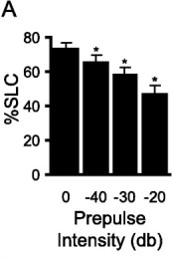
Weak prepulses inhibit short-latency startles
Prepulse inhibition (PPI) is the reduction of a startle when a weak stimulus precedes the startling one. It is a measure of sensorimotor gating, the filtering of sensory input before it reaches motor systems, and is impaired in several neuropsychiatric disorders, including schizophrenia.
Burgess and Granato found that weak prepulses reduced the fraction of larvae performing SLCs, more so as the prepulse became stronger, without changing LLC frequency or SLC kinematics. The dopamine agonist apomorphine disrupted PPI, and the antipsychotic haloperidol, a D2 receptor antagonist, blocked that disruption, as in mammals.
Tabor and colleagues identified a cluster of about 30 neurons that suppress auditory transmission during PPI. They project to the termination zone of auditory afferents on the M-cell lateral dendrite and reduce glutamate release from those afferents, a presynaptic inhibition that spares auditory signaling to other brain regions.
Burgess & Granato (2007), Fig. 5A. Fraction of larvae performing SLCs after prepulses of increasing intensity (dB relative to the startle stimulus).
Burgess & Granato (2007); Tabor et al. (2018)
43
Notes:
• Prepulse inhibition is a classic measure of sensory filtering: a weak sound shortly before a loud one makes the startle smaller.
– It is impaired in several psychiatric conditions, including schizophrenia, which is why it is studied in so many species.
• Burgess and Granato showed that zebrafish larvae have it.
– A weak prepulse reduced short-latency startles, more so with stronger prepulses, but left long-latency C-bends and the shape of the startle unchanged.
– The dopamine agonist apomorphine disrupted it, and the antipsychotic haloperidol prevented that disruption, just as in mammals.
• Tabor and colleagues found where the gating happens.
– About 30 neurons project onto the auditory afferent terminals on the Mauthner cell's lateral dendrite and reduce their glutamate release.
– This presynaptic inhibition blocks the auditory signal to the startle circuit while leaving auditory signaling to the rest of the brain intact.
References:
Burgess HA, Granato M (2007). Sensorimotor gating in larval zebrafish. Journal of Neuroscience 27(18): 4984–4994. https://doi.org/10.1523/JNEUROSCI.0615-07.2007
Tabor KM, Smith TS, Brown M, Bergeron SA, Briggman KL, Burgess HA (2018). Presynaptic inhibition selectively gates auditory transmission to the brainstem startle circuit. Current Biology 28(16): 2527–2535.e8. https://doi.org/10.1016/j.cub.2018.06.020
Figure: Burgess & Granato (2007), Fig. 5A. Fraction of larvae performing SLCs after prepulses of increasing intensity (dB relative to the startle stimulus).
Figure source: https://doi.org/10.1523/JNEUROSCI.0615-07.2007

Slide 57
Presynaptic gating spares other targets of the same input
Inhibition can act at two sites. Postsynaptic inhibition, like the glycinergic feedforward input, opens channels on the M-cell itself and reduces its response to everything it receives. Presynaptic inhibition acts on one set of axon terminals, reducing transmitter release from those terminals alone while the same axons keep signaling at their other synapses.
Prepulse inhibition uses the presynaptic form. The gating neurons reduce glutamate release from auditory afferents onto the M-cell dendrite, so a weak prepulse lowers the chance of a short-latency startle while the sound still reaches the rest of the brain. That selectivity is consistent with the prepulse leaving long-latency escapes and startle kinematics unchanged.
Separate sites allow separate control. Cortisol weakened feedforward inhibition and lowered the current needed to fire the M-cell, yet prepulse inhibition persisted, as expected for a prepulse network lying outside the hindbrain startle circuit. Habituation adds a third site, depressed dendritic excitation within the M-cell, so stress, repetition and a warning sound adjust the startle independently.
Burgess & Granato (2007), Fig. 5A. Fraction of larvae performing SLCs after prepulses of increasing intensity (dB relative to the startle stimulus).
Tabor et al. (2018); Bronson & Preuss (2017); Burgess & Granato (2007)
43a
Notes:
• Slides 42 to 44 describe three ways the startle is turned down or up; locating each one in the circuit explains why they can act independently.
• The site of inhibition determines what it affects.
– Inhibition on the M-cell membrane, such as the feedforward glycinergic input on slide 26, reduces the cell's response to auditory, visual and spiral fiber input alike.
– Inhibition on afferent terminals reduces only the transmission from those terminals onto that target.
• Prepulse inhibition is the presynaptic kind.
– Tabor and colleagues measured auditory nerve transmitter release directly and found it reduced onto the M-cell but not onto other brain regions.
– Burgess and Granato had already seen that a prepulse removes short-latency startles while leaving long-latency C-bends as frequent as before.
• Independent sites mean independent modulation.
– Bronson and Preuss tested cortisol and prepulse inhibition together: threshold current rose during the prepulse both before and after cortisol, while cortisol shifted it down overall.
– Marsden and Granato located habituation in reduced dendritic calcium signals in the M-cell itself, a third, separate locus.
References:
Tabor KM, Smith TS, Brown M, Bergeron SA, Briggman KL, Burgess HA (2018). Presynaptic inhibition selectively gates auditory transmission to the brainstem startle circuit. Current Biology 28(16): 2527–2535.e8. https://doi.org/10.1016/j.cub.2018.06.020
Bronson DR, Preuss T (2017). Cellular mechanisms of cortisol-induced changes in Mauthner-cell excitability in the startle circuit of goldfish. Frontiers in Neural Circuits 11: 68. https://doi.org/10.3389/fncir.2017.00068
Burgess HA, Granato M (2007). Sensorimotor gating in larval zebrafish. Journal of Neuroscience 27(18): 4984–4994. https://doi.org/10.1523/JNEUROSCI.0615-07.2007
Marsden KC, Granato M (2015). In vivo Ca2+ imaging reveals that decreased dendritic excitability drives startle habituation. Cell Reports 13(9): 1733–1740. https://doi.org/10.1016/j.celrep.2015.10.060

Slide 58
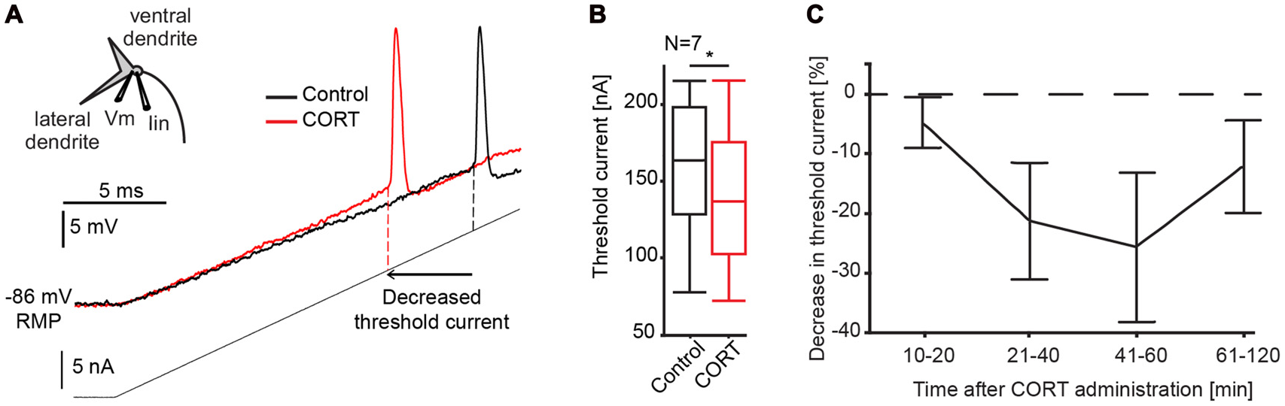
Cortisol rapidly raises M-cell excitability
Predator pressure and alarm substance, a chemical released from injured fish skin, modulate C-starts, and the stress hormone cortisol is a candidate mediator. Bronson and Preuss recorded goldfish M-cells intracellularly before and after cortisol (CORT).
A ramp of injected current reached spike threshold earlier after cortisol, meaning that less current was needed to fire the cell. Threshold current decreased within 10 minutes and returned toward baseline over an hour. The speed suggests non-genomic mechanisms, acting without changes in gene transcription.
Cortisol increased the M-cell's input resistance near threshold, a voltage-dependent postsynaptic effect that the authors attributed to a chloride conductance. It also enlarged sound-evoked PSPs by reducing feedforward inhibition, while the separate network mediating prepulse inhibition was unaffected. A stress hormone can therefore adjust escape probability through a single command neuron.
Bronson & Preuss (2017), Fig. 3A–C. M-cell response to a current ramp before (black) and after cortisol (red); threshold current and its time course.
Bronson & Preuss (2017)
44
Notes:
• Fish exposed to predators or to alarm substance, a chemical released from injured skin, change their C-starts, and cortisol, the main fish stress hormone, could be involved.
– Bronson and Preuss recorded from goldfish Mauthner cells while applying cortisol.
• Cortisol made the Mauthner cell easier to fire.
– Less injected current was needed to reach threshold within 10 minutes, and the effect faded over about an hour.
– That speed points to non-genomic actions, effects that do not require changes in gene expression.
• They identified two mechanisms.
– Cortisol raised the cell's input resistance near threshold, so the same current depolarizes it more, and the authors proposed a chloride conductance as the target.
– It also weakened feedforward inhibition, which made sound responses larger, while prepulse inhibition was unaffected.
References:
Bronson DR, Preuss T (2017). Cellular mechanisms of cortisol-induced changes in Mauthner-cell excitability in the startle circuit of goldfish. Frontiers in Neural Circuits 11: 68. https://doi.org/10.3389/fncir.2017.00068
Figure: Bronson & Preuss (2017), Fig. 3A–C. M-cell response to a current ramp before (black) and after cortisol (red); threshold current and its time course.
Figure source: https://doi.org/10.3389/fncir.2017.00068

Slide 59
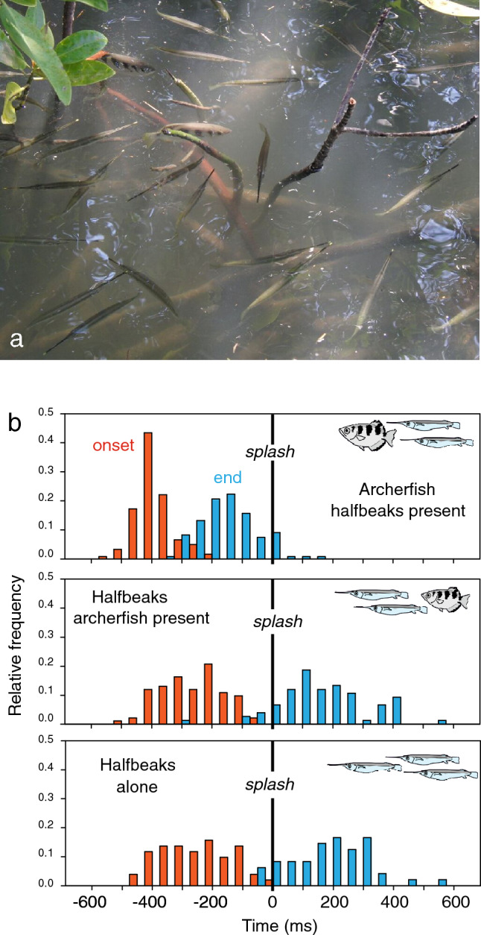
Archerfish use a C-start to reach falling prey first
Archerfish shoot down insects with jets of water, then compete with other surface-feeding fish for the falling prey. Schuster describes how hunting archerfish turn toward the point where the prey will land, using only information sampled shortly after the prey starts to fall.
This predictive C-start cannot be distinguished kinematically from an escape C-start made by the same fish, and it is among the fastest C-starts known in teleosts. The start itself gives the fish the speed needed to arrive at the right time.
In the field in Thailand, archerfish compete with halfbeaks that are more sensitive to surface waves. All archerfish C-starts began before the prey hit the water, and the archerfish secured over 98% of the prey. Archerfish and goldfish M-cells have similar shapes, but visual PSPs are larger in archerfish, consistent with the proposal that the M-cell participates in this visually guided decision.
Schuster (2023), Fig. 3. Archerfish and halfbeaks in the field (a); timing of C-start onset (red) and end (blue) relative to prey impact (b).
Schuster (2023)
45
Notes:
• Archerfish knock insects into the water by spitting, and then have to get to the prey before other fish do.
– Schuster's work shows that they decide where to go from information collected just after the insect starts to fall, and then turn toward the future landing point.
• They make that turn with a C-start.
– The movement is indistinguishable from the same fish's escape C-start and is among the fastest known in teleosts, and the start alone gives the fish enough speed to arrive on time.
• In the field, archerfish share their habitat with halfbeaks, which respond strongly to surface waves.
– Every archerfish C-start began before the prey splashed down, and archerfish got more than 98 percent of the prey.
– Their Mauthner cells look like goldfish Mauthner cells but have larger visual responses, consistent with the idea that the Mauthner cell helps trigger this visually guided hunting decision.
References:
Schuster S (2023). The archerfish predictive C-start. Journal of Comparative Physiology A 209(5): 827–837. https://doi.org/10.1007/s00359-023-01658-2
Figure: Schuster (2023), Fig. 3. Archerfish and halfbeaks in the field (a); timing of C-start onset (red) and end (blue) relative to prey impact (b).
Figure source: https://doi.org/10.1007/s00359-023-01658-2

Slide 60
Key takeaways
A single spike triggers the C-start. One Mauthner-cell spike precedes contraction of the opposite trunk; stage 1 bends the fish into a C within about 20 ms, and stage 2 propels it away on a trajectory fixed before feedback arrives.
The Mauthner cell integrates senses at distinct sites. Auditory club endings on the lateral dendrite are mixed synapses, electrical through Cx35.5 (presynaptic) and Cx34.1 (postsynaptic) anchored by ZO1b, plus glutamatergic; vision reaches the ventral dendrite and spiral fibers excite the axon initial segment.
Inhibition chooses the side and sets the threshold. Feedforward glycinergic neurons inhibit the opposite M-cell more strongly and act electrically through the high-resistance axon cap; spinal CoLo neurons block a late second command.
Potassium channels enforce single spiking. Low-threshold Kv7.4 and Kvβ2-associated Kv1.1 currents restrict the M-cell to one short-latency spike, unlike its repetitively firing homologs MiD2cm and MiD3cm.
Fast and flexible escapes use parallel pathways. Short-latency C-bends require the M-cell axon and its initial segment and improve survival; long-latency, flexible escapes are driven by separate prepontine neurons selected at lower threat levels.
The startle is continuously modulated. Spiral fiber excitability sets the innate threshold, NMDA-dependent depression of excitation underlies habituation, presynaptic inhibition produces prepulse inhibition, and cortisol increases M-cell excitability.
Eaton et al. (1977); Korn & Faber (2005); Koyama et al. (2016); Hecker et al. (2020)
46
Notes:
Eaton RC, Bombardieri RA, Meyer DL (1977). The Mauthner-initiated startle response in teleost fish. Journal of Experimental Biology 66: 65–81. https://doi.org/10.1242/jeb.66.1.65
Zottoli SJ (1977). Correlation of the startle reflex and Mauthner cell auditory responses in unrestrained goldfish. Journal of Experimental Biology 66: 243–254. https://doi.org/10.1242/jeb.66.1.243
Eaton RC, DiDomenico R, Nissanov J (1988). Flexible body dynamics of the goldfish C-start: implications for reticulospinal command mechanisms. Journal of Neuroscience 8(8): 2758–2768. https://doi.org/10.1523/JNEUROSCI.08-08-02758.1988
Eaton RC, Emberley DS (1991). How stimulus direction determines the trajectory of the Mauthner-initiated escape response in a teleost fish. Journal of Experimental Biology 161: 469–487. https://doi.org/10.1242/jeb.161.1.469
Foreman MB, Eaton RC (1993). The direction change concept for reticulospinal control of goldfish escape. Journal of Neuroscience 13(10): 4101–4113. https://doi.org/10.1523/JNEUROSCI.13-10-04101.1993
Korn H, Faber DS (2005). The Mauthner cell half a century later: a neurobiological model for decision-making? Neuron 47(1): 13–28. https://doi.org/10.1016/j.neuron.2005.05.019
Furshpan EJ (1964). "Electrical transmission" at an excitatory synapse in a vertebrate brain. Science 144(3620): 878–880. https://doi.org/10.1126/science.144.3620.878
Fukami Y, Furukawa T, Asada Y (1965). Excitability changes of the Mauthner cell during collateral inhibition. Journal of General Physiology 48(4): 581–600. https://doi.org/10.1085/jgp.48.4.581
Kohashi T, Oda Y (2008). Initiation of Mauthner- or non-Mauthner-mediated fast escape evoked by different modes of sensory input. Journal of Neuroscience 28(42): 10641–10653. https://doi.org/10.1523/JNEUROSCI.1435-08.2008
Weiss SA, Preuss T, Faber DS (2008). A role of electrical inhibition in sensorimotor integration. Proceedings of the National Academy of Sciences USA 105(46): 18047–18052. https://doi.org/10.1073/pnas.0806145105
Weiss SA, Faber DS (2010). Field effects in the CNS play functional roles. Frontiers in Neural Circuits 4: 15. https://doi.org/10.3389/fncir.2010.00015
Fetcho JR, Faber DS (1988). Identification of motoneurons and interneurons in the spinal network for escapes initiated by the Mauthner cell in goldfish. Journal of Neuroscience 8(11): 4192–4213. https://doi.org/10.1523/JNEUROSCI.08-11-04192.1988
Satou C, Kimura Y, Kohashi T, Horikawa K, Takeda H, Oda Y, Higashijima S (2009). Functional role of a specialized class of spinal commissural inhibitory neurons during fast escapes in zebrafish. Journal of Neuroscience 29(21): 6780–6793. https://doi.org/10.1523/JNEUROSCI.0801-09.2009
Liu KS, Fetcho JR (1999). Laser ablations reveal functional relationships of segmental hindbrain neurons in zebrafish. Neuron 23(2): 325–335. https://doi.org/10.1016/S0896-6273(00)80783-7
Lacoste AM, Schoppik D, Robson DN, Haesemeyer M, Portugues R, Li JM, Randlett O, Wee CL, Engert F, Schier AF (2015). A convergent and essential interneuron pathway for Mauthner-cell-mediated escapes. Current Biology 25(11): 1526–1534. https://doi.org/10.1016/j.cub.2015.04.025
Dunn TW, Gebhardt C, Naumann EA, Riegler C, Ahrens MB, Engert F, Del Bene F (2016). Neural circuits underlying visually evoked escapes in larval zebrafish. Neuron 89(3): 613–628. https://doi.org/10.1016/j.neuron.2015.12.021
Tabor KM, Smith TS, Brown M, Bergeron SA, Briggman KL, Burgess HA (2018). Presynaptic inhibition selectively gates auditory transmission to the brainstem startle circuit. Current Biology 28(16): 2527–2535.e8. https://doi.org/10.1016/j.cub.2018.06.020
Pantoja C, Hoagland A, Carroll EC, Karalis V, Conner A, Isacoff EY (2016). Neuromodulatory regulation of behavioral individuality in zebrafish. Neuron 91(3): 587–601. https://doi.org/10.1016/j.neuron.2016.06.016
Bhattacharyya K, McLean DL, MacIver MA (2017). Visual threat assessment and reticulospinal encoding of calibrated responses in larval zebrafish. Current Biology 27(18): 2751–2762.e6. https://doi.org/10.1016/j.cub.2017.08.012
Marsden KC, Granato M (2015). In vivo Ca2+ imaging reveals that decreased dendritic excitability drives startle habituation. Cell Reports 13(9): 1733–1740. https://doi.org/10.1016/j.celrep.2015.10.060
Roberts AC, Reichl J, Song MY, Dearinger AD, Moridzadeh N, Lu ED, Pearce K, Esdin J, Glanzman DL (2011). Habituation of the C-start response in larval zebrafish exhibits several distinct phases and sensitivity to NMDA receptor blockade. PLoS ONE 6(12): e29132. https://doi.org/10.1371/journal.pone.0029132
Burgess HA, Granato M (2007). Sensorimotor gating in larval zebrafish. Journal of Neuroscience 27(18): 4984–4994. https://doi.org/10.1523/JNEUROSCI.0615-07.2007
Preuss T, Osei-Bonsu PE, Weiss SA, Wang C, Faber DS (2006). Neural representation of object approach in a decision-making motor circuit. Journal of Neuroscience 26(13): 3454–3464. https://doi.org/10.1523/JNEUROSCI.5259-05.2006
Koyama M, Minale F, Shum J, Nishimura N, Schaffer CB, Fetcho JR (2016). A circuit motif in the zebrafish hindbrain for a two alternative behavioral choice to turn left or right. eLife 5: e16808. https://doi.org/10.7554/eLife.16808
Miller AC, Whitebirch AC, Shah AN, Marsden KC, Granato M, O'Brien J, Moens CB (2017). A genetic basis for molecular asymmetry at vertebrate electrical synapses. eLife 6: e25364. https://doi.org/10.7554/eLife.25364
Lasseigne AM, Echeverry FA, Ijaz S, Michel JC, Martin EA, Marsh AJ, Trujillo E, Marsden KC, Pereda AE, Miller AC (2021). Electrical synaptic transmission requires a postsynaptic scaffolding protein. eLife 10: e66898. https://doi.org/10.7554/eLife.66898
Otero-Coronel S, Preuss T, Medan V (2024). Multisensory integration enhances audiovisual responses in the Mauthner cell. eLife 13: RP99424. https://doi.org/10.7554/eLife.99424
Hecker A, Schulze W, Oster J, Richter DO, Schuster S (2020). Removing a single neuron in a vertebrate brain forever abolishes an essential behavior. Proceedings of the National Academy of Sciences USA 117(6): 3254–3260. https://doi.org/10.1073/pnas.1918578117
Martorell N, Medan V (2022). Audiovisual integration in the Mauthner cell enhances escape probability and reduces response latency. Scientific Reports 12: 1097. https://doi.org/10.1038/s41598-022-04998-2
Bátora D, Zsigmond Á, Lőrincz IZ, Szegvári G, Varga M, Málnási-Csizmadia A (2021). Subcellular dissection of a simple neural circuit: functional domains of the Mauthner-cell during habituation. Frontiers in Neural Circuits 15: 648487. https://doi.org/10.3389/fncir.2021.648487
Bronson DR, Preuss T (2017). Cellular mechanisms of cortisol-induced changes in Mauthner-cell excitability in the startle circuit of goldfish. Frontiers in Neural Circuits 11: 68. https://doi.org/10.3389/fncir.2017.00068
Watanabe T, Shimazaki T, Oda Y (2017). Coordinated expression of two types of low-threshold K+ channels establishes unique single spiking of Mauthner cells among segmentally homologous neurons in the zebrafish hindbrain. eNeuro 4(5): ENEURO.0249-17.2017. https://doi.org/10.1523/ENEURO.0249-17.2017
Echeverry FA, Ijaz S, Pereda AE (2022). Recording synaptic transmission from auditory mixed synapses on the Mauthner cells of developing zebrafish. eNeuro 9(3): ENEURO.0021-22.2022. https://doi.org/10.1523/ENEURO.0021-22.2022
Marquart GD, Tabor KM, Bergeron SA, Briggman KL, Burgess HA (2019). Prepontine non-giant neurons drive flexible escape behavior in zebrafish. PLoS Biology 17(10): e3000480. https://doi.org/10.1371/journal.pbio.3000480
Marsden KC, Jain RA, Wolman MA, Echeverry FA, Nelson JC, Hayer KE, Miltenberg B, Pereda AE, Granato M (2018). A Cyfip2-dependent excitatory interneuron pathway establishes the innate startle threshold. Cell Reports 23(3): 878–887. https://doi.org/10.1016/j.celrep.2018.03.095
Schuster S (2023). The archerfish predictive C-start. Journal of Comparative Physiology A 209(5): 827–837. https://doi.org/10.1007/s00359-023-01658-2

