Slide 1
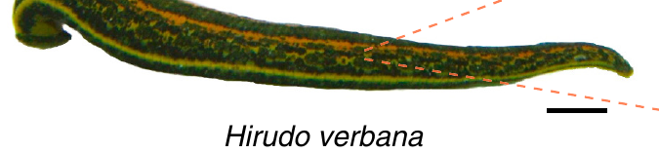
NEUR 411 · NEUROETHOLOGY · FALL 2026 · Lecture 6
Central pattern generators I: leech swimming and crawling (Kristan)
Friday, September 4, 2026
Jordan Lopez, Ph.D.
Ashaber et al. (2021), Fig. 1. Medicinal leech Hirudo verbana; original 1 cm scale bar.
Notes:
Central pattern generators I: leech swimming and crawling (Kristan)
Friday, September 4, 2026
Ashaber et al. (2021), Fig. 1. Medicinal leech Hirudo verbana; original 1 cm scale bar.
Source: https://doi.org/10.7554/eLife.61881
Full reference: M. Ashaber; Y. Tomina; P. Kassraian; E. A. Bushong; W. B. Kristan Jr; M. H. Ellisman; D. A. Wagenaar (2021). Anatomy and activity patterns in a multifunctional motor neuron and its surrounding circuits. eLife 10:e61881. https://doi.org/10.7554/eLife.61881

Slide 2
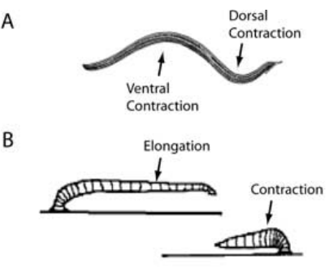
Swimming and crawling reorganize the same muscles
Leech swimming consists of alternating contractions of dorsal and ventral longitudinal muscles, producing a wave that travels toward the tail. Crawling instead alternates elongation, driven by circular muscles, with shortening, driven by longitudinal muscles. The front and rear suckers attach and release to convert these changes into forward movement.
Briggman and Kristan elicited both motor patterns in the same isolated nervous system while monitoring motor nerves and recording individual neurons. Swimming occurred at approximately 1–1.5 Hz, whereas crawling oscillations occurred at approximately 0.04–0.1 Hz. The different rhythms reorganized common motor outputs.
A central pattern generator, or CPG, is a neural circuit capable of producing a patterned rhythm without requiring rhythmic sensory input. Both leech rhythms persist in the isolated nerve cord, and most neurons that oscillate with swimming also oscillate with crawling.
Briggman & Kristan (2006), Fig. 1(A,B). Published swimming and crawling movement sequences.
Briggman & Kristan (2006)
2
Notes:
Teaching transcript:
Leech swimming consists of alternating contractions of dorsal and ventral longitudinal muscles, producing a wave that travels toward the tail. Crawling instead alternates elongation, driven by circular muscles, with shortening, driven by longitudinal muscles. The front and rear suckers attach and release to convert these changes into forward movement.
Briggman and Kristan elicited both motor patterns in the same isolated nervous system while monitoring motor nerves and recording individual neurons. Swimming occurred at approximately 1–1.5 Hz, whereas crawling oscillations occurred at approximately 0.04–0.1 Hz. The different rhythms reorganized common motor outputs.
A central pattern generator, or CPG, is a neural circuit capable of producing a patterned rhythm without requiring rhythmic sensory input. Central generation does not imply that sensory feedback, descending signals, or the mechanical environment are irrelevant to the realized movement.
Dorsal refers to the back surface and ventral to the belly surface. Longitudinal muscle contraction shortens the body; circular muscle contraction contributes to elongation. These muscle arrangements give the same animal two distinct forms of locomotion.
References:
K. L. Briggman; W. B. Kristan Jr (2006). Imaging dedicated and multifunctional neural circuits generating distinct behaviors. Journal of Neuroscience 26(42):10925–10933. https://doi.org/10.1523/JNEUROSCI.3265-06.2006
Briggman & Kristan (2006), Fig. 1(A,B). Published swimming and crawling movement sequences.
Figure source: https://doi.org/10.1523/JNEUROSCI.3265-06.2006

Slide 3
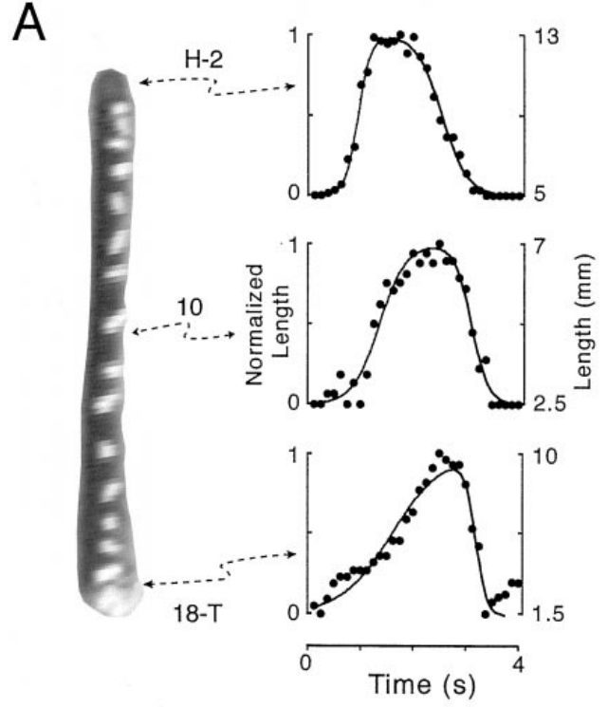
Segmental markers resolve the components of a crawl
Kinematics describes movement without assigning its underlying forces or neural causes. Cacciatore and colleagues attached small thread markers to segment boundaries in adult leeches and recorded crawling from above. Their analysis used vermiform steps, in which the body remained near the substrate, rather than steps with a raised body loop.
Video was digitized at 4–10 frames per second, with at least 25 frames per step. Distances between markers yielded segmental length changes. Anterior segments generally elongated earlier than posterior ones; the reverse transition to shortening also propagated toward the tail.
The preparation connects whole-animal movement to regional timing. Applying the same marker analysis to surgically altered animals, the investigators found that crawling steps continued after removal of both the head and tail brains, placing a step generator in the midbody ganglia.
Cacciatore et al. (2000), Fig. 2(A). Marked leech and measured regional length changes.
Cacciatore et al. (2000)
3
Notes:
Teaching transcript:
Kinematics describes movement without assigning its underlying forces or neural causes. Cacciatore and colleagues attached small thread markers to segment boundaries in adult leeches and recorded crawling from above. Their analysis used vermiform steps, in which the body remained near the substrate, rather than steps with a raised body loop.
Video was digitized at 4–10 frames per second, with at least 25 frames per step. Distances between markers yielded segmental length changes. Anterior segments generally elongated earlier than posterior ones; the reverse transition to shortening also propagated toward the tail.
The preparation connects whole-animal movement to regional timing. Marker displacement measures body deformation, not motor-neuron firing. The investigators excluded searching movements, so these results characterize stereotyped steps on a smooth surface rather than every possible form of crawling.
The study used adults weighing 2–4 g, allowed recovery after marker implantation, and calibrated spatial measurements with a visible grid. These controls reduced confusion between image scale, recovery effects, and actual changes in movement.
References:
T. W. Cacciatore; R. Rozenshteyn; W. B. Kristan Jr (2000). Kinematics and modeling of leech crawling: evidence for an oscillatory behavior produced by propagating waves of excitation. Journal of Neuroscience 20(4):1643–1655. https://doi.org/10.1523/JNEUROSCI.20-04-01643.2000
Cacciatore et al. (2000), Fig. 2(A). Marked leech and measured regional length changes.
Figure source: https://doi.org/10.1523/JNEUROSCI.20-04-01643.2000

Slide 4
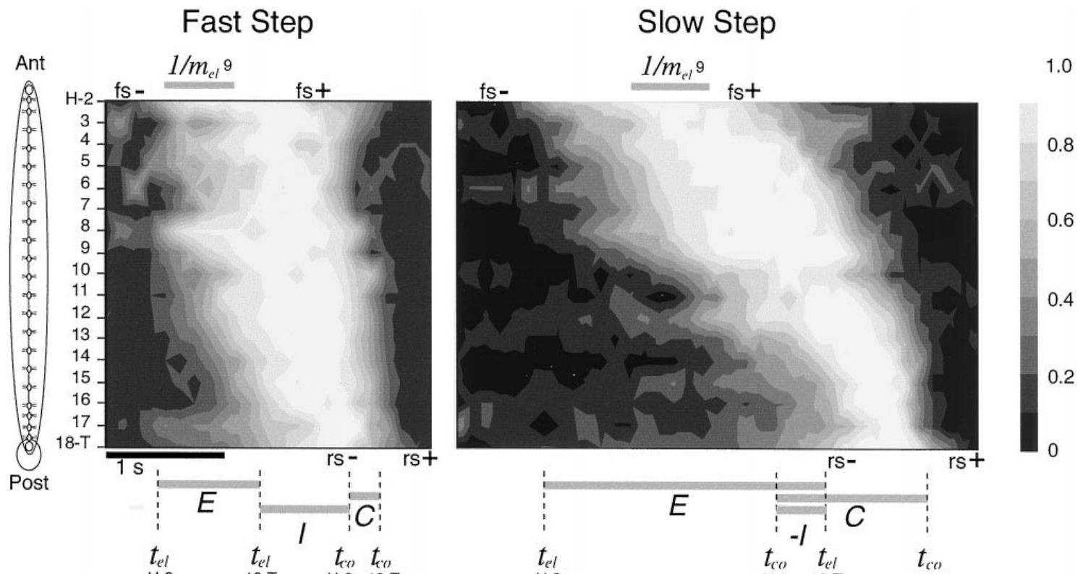
Crawl duration changes the speed of traveling waves
Cacciatore and colleagues compared segmental length changes during fast and slow crawling steps. Propagation means that a change begins in successive body regions at different times. Both elongation and contraction propagated from anterior to posterior segments rather than occurring simultaneously throughout the body.
Typical stereotyped steps lasted approximately 2–10 s. Slower steps contained slower wave propagation and changes in the interval between elongation and contraction. Anterior regions could begin contracting while posterior regions were still elongating, so whole-body elongation and contraction were not strictly separate blocks.
These observations constrain a neural explanation of crawling to account for regional timing and variable step duration. Within each segment, the rates of elongation and contraction stayed relatively constant from step to step; slower steps arose mainly from longer delays between segments.
Cacciatore et al. (2000), Fig. 3. Measured segment-length sequences during fast and slow steps.
Cacciatore et al. (2000)
4
Notes:
Teaching transcript:
Cacciatore and colleagues compared segmental length changes during fast and slow crawling steps. Propagation means that a change begins in successive body regions at different times. Both elongation and contraction propagated from anterior to posterior segments rather than occurring simultaneously throughout the body.
Typical stereotyped steps lasted approximately 2–10 s. Slower steps contained slower wave propagation and changes in the interval between elongation and contraction. Anterior regions could begin contracting while posterior regions were still elongating, so whole-body elongation and contraction were not strictly separate blocks.
These observations constrain a neural explanation of crawling to account for regional timing and variable step duration. The recorded waves are behavioral data. The paper’s proposed excitation-chain model is an explanatory construction and does not establish that its specific simulated neurons exist in the leech.
A contour representation of measured length preserves the sequence of local lengthening and shortening. The important experimental relationship is that different portions of the body can occupy different movement phases during one step.
References:
T. W. Cacciatore; R. Rozenshteyn; W. B. Kristan Jr (2000). Kinematics and modeling of leech crawling: evidence for an oscillatory behavior produced by propagating waves of excitation. Journal of Neuroscience 20(4):1643–1655. https://doi.org/10.1523/JNEUROSCI.20-04-01643.2000
Cacciatore et al. (2000), Fig. 3. Measured segment-length sequences during fast and slow steps.
Figure source: https://doi.org/10.1523/JNEUROSCI.20-04-01643.2000

Slide 5
Each midbody ganglion controls the segment it sits in
The leech nervous system is a chain of 21 midbody ganglia flanked by head and tail brains. Each ganglion holds about 400 neurons and governs one segment: its sensory and motor neurons reach that segment through root nerves, while axon bundles called connectives join it to neighboring ganglia.
This layout gives every experiment two separable routes to cut. Severing roots detaches a ganglion from its body segment but leaves it talking to its neighbors; severing connectives detaches it from other ganglia but leaves its segment attached. Each surgery in the deck removes one route and asks what the other achieves alone.
Within a ganglion, cell bodies form a single layer around a central neuropil where neurites meet at chemical and electrical synapses. The same identified neurons repeat from segment to segment, so a motor neuron such as DE-3 can be found and compared across ganglia and animals, and a single ganglion can serve as the unit for imaging or for testing rhythm generation.
Cacciatore et al. (2000), Fig. 2(A). Marked leech and measured regional length changes.
Ashaber et al. (2021); Kearney et al. (2022)
4a
Notes:
The marker experiments on slides 3 and 4 measure segments; everything later in the deck manipulates the ganglia that run those segments, so the layout of the leech nervous system is worth having in hand.
The body plan repeats.
Kearney and colleagues describe 21 nearly identical midbody segments, each controlled by its own midbody ganglion that contains all the sensory and motor neurons innervating that segment.
Ashaber and colleagues give the size of each ganglion as roughly 400 neurons, small enough that most of them can be imaged at once.
Roots and connectives are different cuts.
Cacciatore's denervation on slide 5 cut roots and kept connectives; Yu's transection on slide 13 cut the cord and kept the body; the isolated cords of slides 6 and 28 removed the body entirely.
Knowing which route each surgery spares is what allows the deck to attribute coordination to central or peripheral pathways.
Identified neurons make comparison possible.
Somata sit in a shell around the neuropil, and each identified cell has a recognizable position and size, which is how DE-3, CV and the inhibitors can be found again in every preparation.
Ashaber and colleagues add that a single ganglion captures the pathway from sensory input through interneuronal rhythms to motor output, which is why so many experiments use one.
References:
M. Ashaber; Y. Tomina; P. Kassraian; E. A. Bushong; W. B. Kristan Jr; M. H. Ellisman; D. A. Wagenaar (2021). Anatomy and activity patterns in a multifunctional motor neuron and its surrounding circuits. eLife 10:e61881. https://doi.org/10.7554/eLife.61881
G. Kearney; M. Radice; A. Sanchez Merlinsky; L. Szczupak (2022). Intersegmental interactions give rise to a global network. Frontiers in Neural Circuits 16:843731. https://doi.org/10.3389/fncir.2022.843731

Slide 6
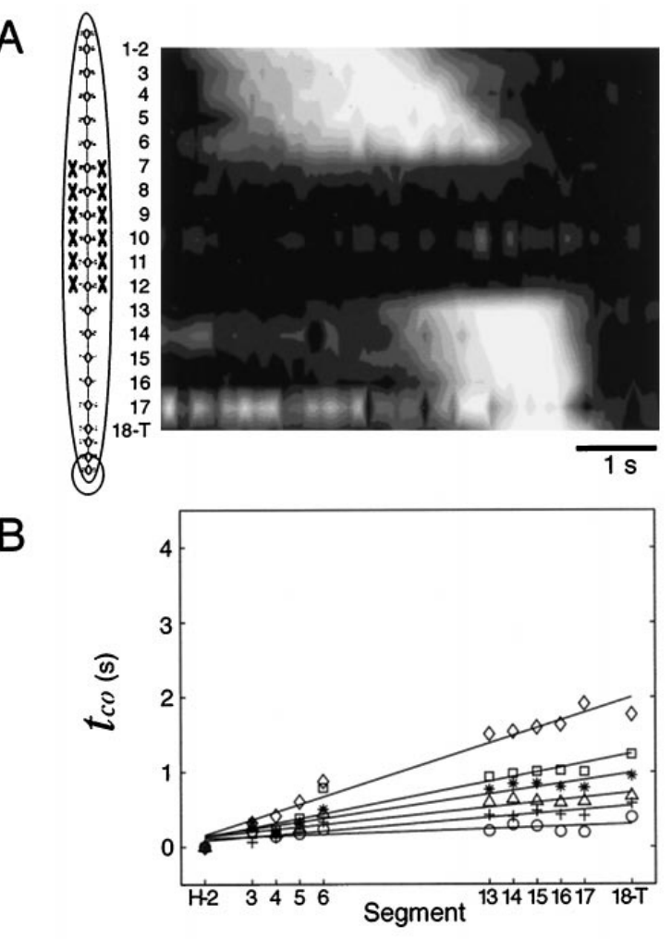
Crawl waves can cross denervated body segments
Cacciatore and colleagues severed the peripheral nerve roots of segments 7–12 while preserving the central connectives between ganglia. Denervation removes neural communication with the body wall. In this preparation it removed both sensory input and motor output in the operated segments, rather than selectively removing sensory neurons.
The denervated segments became flaccid, but elongation and contraction waves continued in the innervated regions on either side. Segmental delays and their relationship to step duration did not acquire a marked discontinuity across the operated region. The comparison used each animal’s movements before and after surgery.
Central communication can therefore coordinate crawl timing across a region deprived of its normal peripheral loop. Sensory pathways still feed back onto the crawl generator: imposing stretch on the body greatly lengthened the transition between elongation and contraction.
Cacciatore et al. (2000), Fig. 7(A,B). Movement timing after removal of peripheral innervation.
Cacciatore et al. (2000)
5
Notes:
Teaching transcript:
Cacciatore and colleagues severed the peripheral nerve roots of segments 7–12 while preserving the central connectives between ganglia. Denervation removes neural communication with the body wall. In this preparation it removed both sensory input and motor output in the operated segments, rather than selectively removing sensory neurons.
The denervated segments became flaccid, but elongation and contraction waves continued in the innervated regions on either side. Segmental delays and their relationship to step duration did not acquire a marked discontinuity across the operated region. The comparison used each animal’s movements before and after surgery.
Central communication can therefore coordinate crawl timing across a region deprived of its normal peripheral loop. This result does not establish that sensory feedback has no role in intact crawling, and it does not identify the central neurons that carry coordination across the lesion.
Connectives are axon bundles linking successive ganglia. Preserving them was essential: cutting both the nerve roots and the connectives would have confounded loss of peripheral feedback with loss of communication along the nervous system.
References:
T. W. Cacciatore; R. Rozenshteyn; W. B. Kristan Jr (2000). Kinematics and modeling of leech crawling: evidence for an oscillatory behavior produced by propagating waves of excitation. Journal of Neuroscience 20(4):1643–1655. https://doi.org/10.1523/JNEUROSCI.20-04-01643.2000
Cacciatore et al. (2000), Fig. 7(A,B). Movement timing after removal of peripheral innervation.
Figure source: https://doi.org/10.1523/JNEUROSCI.20-04-01643.2000

Slide 7
A crawl model passes excitation down the body as a wave
A swim stroke works only if each segment keeps a strict phase relation with its neighbors, whereas a crawl step works by adjusting to the surface one step at a time. Cacciatore and colleagues argued that the crawl generator is organized for flexibility rather than precise coordination.
Their model treats a step as excitation launched near the front and handed backward along chains of excitatory neurons, with a parallel descending projection. Each segment elongates and then contracts as the excitation reaches it, so longer delays along the chain slow the whole step without changing how any one segment moves.
In swimming, by contrast, individual segments produce oscillations that are strongly phase-locked to one another. The denervation result fits the crawl model: excitation carried by central chains can cross segments that have lost their roots, since the chain itself needs no signal from the operated body wall.
Cacciatore et al. (2000), Fig. 7(A,B). Movement timing after removal of peripheral innervation.
Cacciatore et al. (2000)
5a
Notes:
Slide 5 shows crawl waves crossing denervated segments; the paper's model of how a crawl step is generated makes that result expected rather than surprising.
The two behaviors reward different properties.
Cacciatore and colleagues contrast behaviors such as swimming that require regular rhythmicity and strict phase relationships with crawling, whose success depends more on flexibility.
A generator for crawling should therefore allow each step to be lengthened or shortened easily.
The model is a propagating chain, not a ring of oscillators.
An oscillator at the front starts a wave of activity that travels through excitatory neuronal chains, and a descending pathway runs alongside it.
Together these pathways reproduced the observed intersegmental lags, the coordination between phases and the range of step durations.
The comparison with swimming sharpens the distinction.
Swimming segments each oscillate and lock their phases through the connectives and, as slides 13 to 15 reveal, through the moving body.
A chain that simply relays excitation needs no local feedback to keep order, consistent with intact coordination across the denervated segments 7 to 12.
References:
T. W. Cacciatore; R. Rozenshteyn; W. B. Kristan Jr (2000). Kinematics and modeling of leech crawling: evidence for an oscillatory behavior produced by propagating waves of excitation. Journal of Neuroscience 20(4):1643–1655. https://doi.org/10.1523/JNEUROSCI.20-04-01643.2000

Slide 8
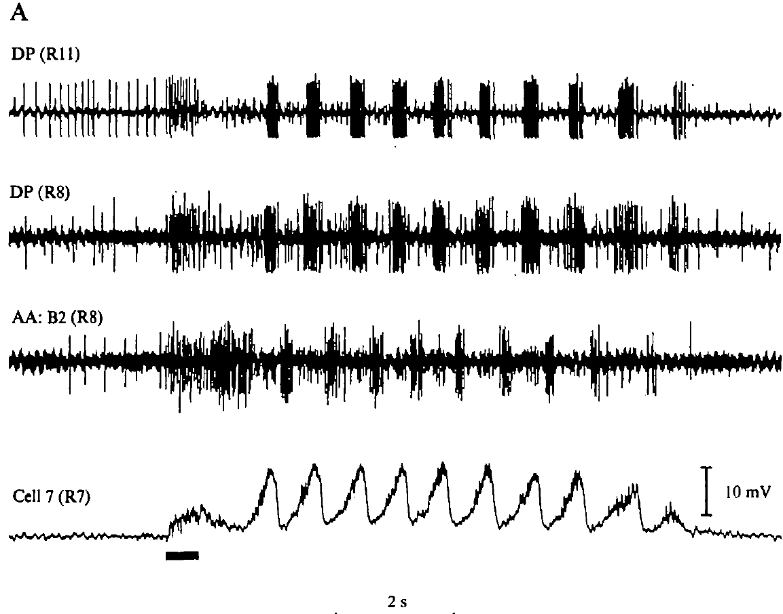
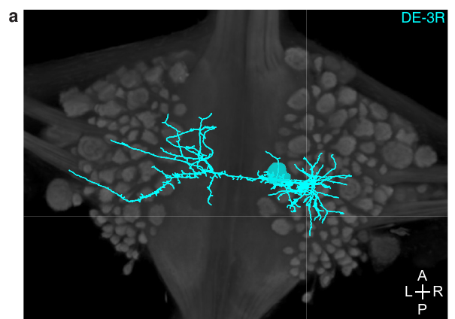
An isolated cord generates a swim-like motor rhythm
Kristan and Calabrese removed the nerve cord from the body wall and recorded from segmental nerves in physiological saline. Brief electrical stimulation initiated repeated bursts in dorsal and ventral motor pathways. The isolated cord had no attached body capable of producing the usual stretch feedback.
A stimulus train of approximately 10–20 Hz for 0.5–1 s could initiate an episode that continued after the stimulation ended. Rhythmic motor activity resembled the pattern recorded during swimming in semi-intact animals. Intracellular motor-neuron recordings contained rhythmic membrane-potential changes associated with the nerve bursts.
Kristan & Calabrese (1976), Fig. 1(A). Motor-nerve bursts and intracellular oscillations in an isolated cord.
The persistence of patterned activity without the peripheral body establishes a central source for the basic swim rhythm. A motor program recorded without the corresponding movement is called fictive locomotion. The 10–20 Hz stimulus contains no swim-frequency rhythm, so the bursts that follow it are timed by the cord itself.
Ashaber et al. (2021), Fig. 7(a). Reconstructed DE-3 arbor over a dorsal micro-CT image.
Kristan & Calabrese (1976); Ashaber et al. (2021)
6
Notes:
Teaching transcript:
Kristan and Calabrese removed the nerve cord from the body wall and recorded from segmental nerves in physiological saline. Brief electrical stimulation initiated repeated bursts in dorsal and ventral motor pathways. The isolated cord had no attached body capable of producing the usual stretch feedback.
A stimulus train of approximately 10–20 Hz for 0.5–1 s could initiate an episode that continued after the stimulation ended. Rhythmic motor activity resembled the pattern recorded during swimming in semi-intact animals. Intracellular motor-neuron recordings contained rhythmic membrane-potential changes associated with the nerve bursts.
The persistence of patterned activity without the peripheral body establishes a central source for the basic swim rhythm. It does not establish normal propulsion, intact sensory calibration, or a particular identified pacemaker neuron. A motor program recorded without the corresponding movement is called fictive locomotion.
An intracellular electrode records voltage within an individual neuron; an extracellular electrode records signals outside cells, here from nerve bundles. The two methods connect membrane-potential oscillations to motor impulses without requiring actual movement.
References:
W. B. Kristan Jr; R. L. Calabrese (1976). Rhythmic swimming activity in neurones of the isolated nerve cord of the leech. Journal of Experimental Biology 65(3):643–668. https://doi.org/10.1242/jeb.65.3.643
M. Ashaber; Y. Tomina; P. Kassraian; E. A. Bushong; W. B. Kristan Jr; M. H. Ellisman; D. A. Wagenaar (2021). Anatomy and activity patterns in a multifunctional motor neuron and its surrounding circuits. eLife 10:e61881. https://doi.org/10.7554/eLife.61881
Kristan & Calabrese (1976), Fig. 1(A). Motor-nerve bursts and intracellular oscillations in an isolated cord.
Figure source: https://doi.org/10.1242/jeb.65.3.643
Ashaber et al. (2021), Fig. 7(a). Reconstructed DE-3 arbor over a dorsal micro-CT image.
Figure source: https://doi.org/10.7554/eLife.61881

Slide 9
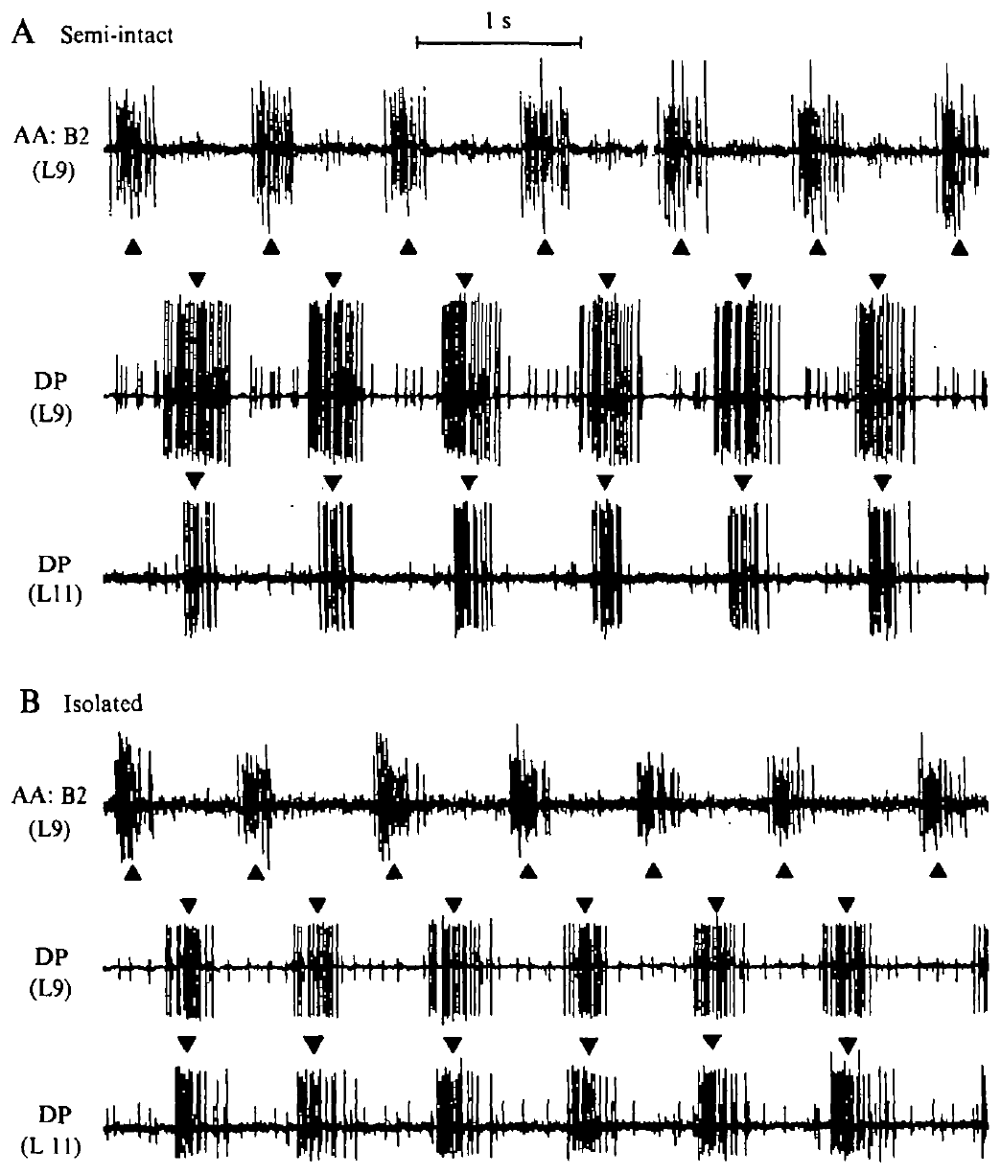
The same preparation retains rhythm after isolation
Kristan and Calabrese first recorded a swimming rhythm from a semi-intact preparation and then disconnected its remaining body wall. Semi-intact means that part of the animal remains capable of movement while another part is opened for recording. Keeping the same recording nerves permitted comparison before and after isolation.
Dorsal-excitor and ventral-excitor bursts continued to alternate after the cord was separated from peripheral tissue. In the illustrated semi-intact recording the cycle period was about 1 s, and homologous dorsal bursts in two segments were separated by approximately 50 ms.
Ashaber et al. (2021), Fig. 7(a). Reconstructed DE-3 arbor over a dorsal micro-CT image.
The within-preparation comparison strengthens the interpretation that central circuitry can generate the alternating pattern. Each cord serves as its own control, so differences between animals, electrode placement or nerve identity cannot account for what changed after isolation.
Kristan & Calabrese (1976), Fig. 2(A,B). Semi-intact and subsequently isolated motor-nerve recordings.
Kristan & Calabrese (1976); Ashaber et al. (2021)
7
Notes:
Teaching transcript:
Kristan and Calabrese first recorded a swimming rhythm from a semi-intact preparation and then disconnected its remaining body wall. Semi-intact means that part of the animal remains capable of movement while another part is opened for recording. Keeping the same recording nerves permitted comparison before and after isolation.
Dorsal-excitor and ventral-excitor bursts continued to alternate after the cord was separated from peripheral tissue. In the illustrated semi-intact recording the cycle period was about 1 s, and homologous dorsal bursts in two segments were separated by approximately 50 ms.
The within-preparation comparison strengthens the interpretation that central circuitry can generate the alternating pattern. It also reveals why preserving a recognizable rhythm is different from preserving every aspect of normal timing. Peripheral removal can alter phase relationships even when the central oscillation remains active.
A cycle period is the interval between successive equivalent events in one rhythm. The investigators used burst midpoints rather than the first spike alone, making their timing definition consistent across bursts of differing duration.
References:
W. B. Kristan Jr; R. L. Calabrese (1976). Rhythmic swimming activity in neurones of the isolated nerve cord of the leech. Journal of Experimental Biology 65(3):643–668. https://doi.org/10.1242/jeb.65.3.643
M. Ashaber; Y. Tomina; P. Kassraian; E. A. Bushong; W. B. Kristan Jr; M. H. Ellisman; D. A. Wagenaar (2021). Anatomy and activity patterns in a multifunctional motor neuron and its surrounding circuits. eLife 10:e61881. https://doi.org/10.7554/eLife.61881
Kristan & Calabrese (1976), Fig. 2(A,B). Semi-intact and subsequently isolated motor-nerve recordings.
Figure source: https://doi.org/10.1242/jeb.65.3.643
Ashaber et al. (2021), Fig. 7(a). Reconstructed DE-3 arbor over a dorsal micro-CT image.
Figure source: https://doi.org/10.7554/eLife.61881

Slide 10
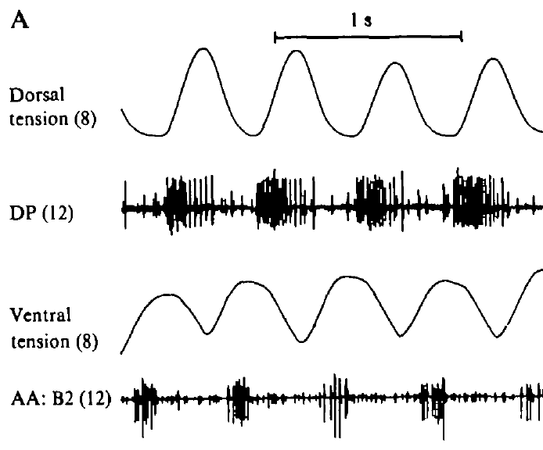
Motor bursts predict alternating muscle contractions
Kristan and Calabrese retained one innervated body segment while separating the rest of the nerve cord from the periphery. Tension transducers measured the dorsal and ventral longitudinal muscle contractions in that segment. Motor-nerve activity was recorded from another ganglion along the cord.
Dorsal and ventral tension rose in alternating phases. Bursts in the corresponding excitatory motor pathways were related to the matching muscle contractions. The body-wall segment and recorded ganglion were separated spatially, so their events included the delay associated with propagation along the cord.
Ashaber et al. (2021), Fig. 7(a). Reconstructed DE-3 arbor over a dorsal micro-CT image.
An excitor is a motor neuron whose output promotes contraction of its target muscle. Alternating dorsal and ventral tension in each segment bends the body up and down, and the rearward delay between segments turns those bends into the traveling wave that propels the leech.
Kristan & Calabrese (1976), Fig. 3(A). Body-wall tension and motor-nerve activity in a nearly isolated preparation.
Kristan & Calabrese (1976); Ashaber et al. (2021)
8
Notes:
Teaching transcript:
Kristan and Calabrese retained one innervated body segment while separating the rest of the nerve cord from the periphery. Tension transducers measured the dorsal and ventral longitudinal muscle contractions in that segment. Motor-nerve activity was recorded from another ganglion along the cord.
Dorsal and ventral tension rose in alternating phases. Bursts in the corresponding excitatory motor pathways were related to the matching muscle contractions. The body-wall segment and recorded ganglion were separated spatially, so their events included the delay associated with propagation along the cord.
An excitor is a motor neuron whose output promotes contraction of its target muscle. The agreement between nerve timing and tension links the electrical pattern to the expected motor action. It does not make an isolated nerve recording a direct measure of swimming thrust or whole-animal displacement.
An inhibitory motor neuron can relax the matching muscle territory and inhibit its excitatory motor neurons. Alternating excitation and inhibition organize contraction across the dorsal and ventral body wall rather than simply turning every motor neuron on together.
References:
W. B. Kristan Jr; R. L. Calabrese (1976). Rhythmic swimming activity in neurones of the isolated nerve cord of the leech. Journal of Experimental Biology 65(3):643–668. https://doi.org/10.1242/jeb.65.3.643
M. Ashaber; Y. Tomina; P. Kassraian; E. A. Bushong; W. B. Kristan Jr; M. H. Ellisman; D. A. Wagenaar (2021). Anatomy and activity patterns in a multifunctional motor neuron and its surrounding circuits. eLife 10:e61881. https://doi.org/10.7554/eLife.61881
Kristan & Calabrese (1976), Fig. 3(A). Body-wall tension and motor-nerve activity in a nearly isolated preparation.
Figure source: https://doi.org/10.1242/jeb.65.3.643
Ashaber et al. (2021), Fig. 7(a). Reconstructed DE-3 arbor over a dorsal micro-CT image.
Figure source: https://doi.org/10.7554/eLife.61881

Slide 11
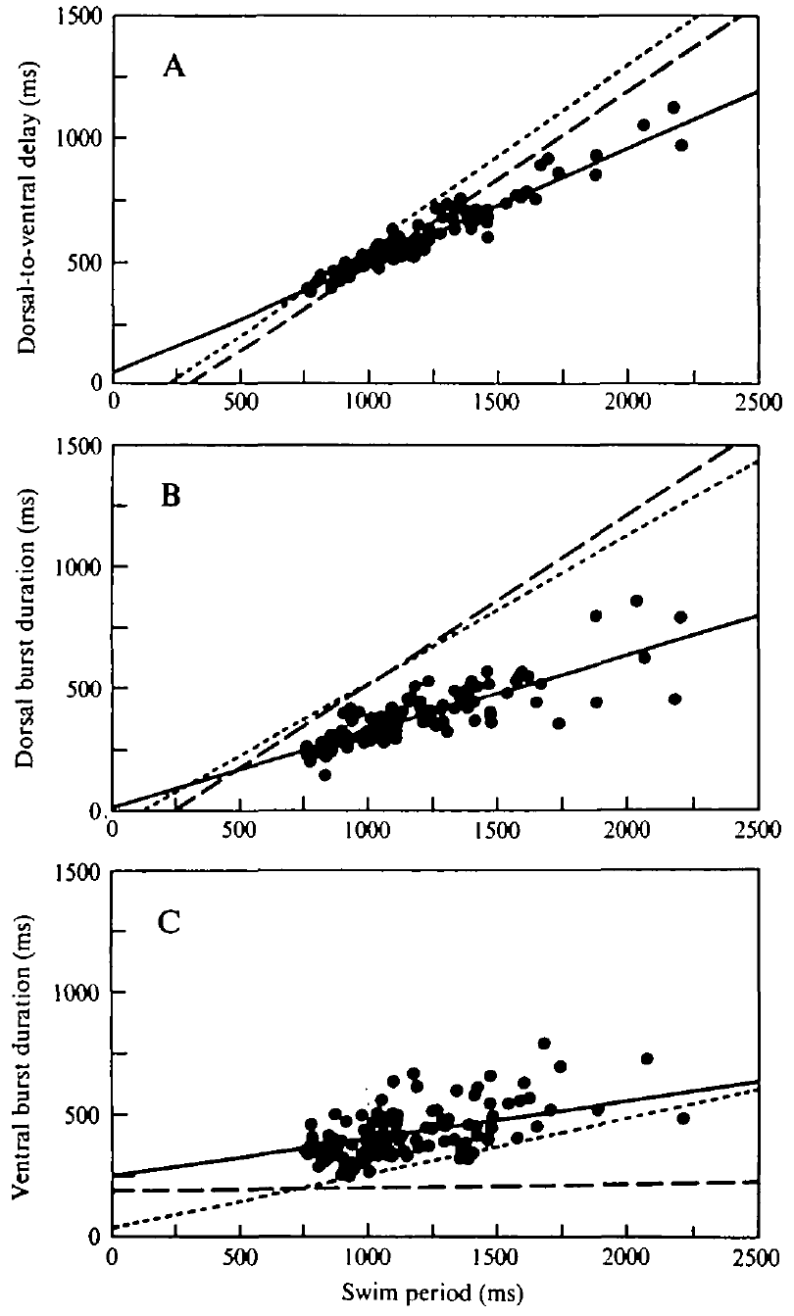
Isolation changes dorsal–ventral timing relationships
Phase describes the position of an event within a repeating cycle. Kristan and Calabrese compared dorsal-to-ventral burst delays over different swim periods. Some isolated preparations retained period-dependent delays, whereas others expressed an approximately constant fractional phase lag.
In semi-intact preparations, dorsal-excitor burst duration increased more strongly with cycle period. In constant-phase isolated preparations, its dependence on period was weaker. Ventral-excitor burst duration was comparatively less dependent on cycle period and did not distinguish the two timing states in the same way.
Ashaber et al. (2021), Fig. 7(a). Reconstructed DE-3 arbor over a dorsal micro-CT image.
Central rhythm production and normal phase calibration are separate properties. Kristan and Calabrese concluded that sensory input determines the phasing of dorsal and ventral motor bursts. The body wall therefore tunes when each muscle group contracts within a cycle that the cord itself produces.
Kristan & Calabrese (1976), Fig. 5(A–C). Measured phase-delay and burst-duration relationships.
Kristan & Calabrese (1976); Ashaber et al. (2021)
9
Notes:
Teaching transcript:
Phase describes the position of an event within a repeating cycle. Kristan and Calabrese compared dorsal-to-ventral burst delays over different swim periods. Some isolated preparations retained period-dependent delays, whereas others expressed an approximately constant fractional phase lag.
In semi-intact preparations, dorsal-excitor burst duration increased more strongly with cycle period. In constant-phase isolated preparations, its dependence on period was weaker. Ventral-excitor burst duration was comparatively less dependent on cycle period and did not distinguish the two timing states in the same way.
Central rhythm production and normal phase calibration are separate properties. The study supports a contribution of peripheral input to the timing relationships expressed during swimming. Isolation does not force every preparation into an identical state, and the comparisons do not identify a single receptor or synaptic connection responsible for the change.
A time delay in milliseconds and a phase lag as a fraction of the cycle are related measurements, but they answer different questions. A fixed fraction requires the absolute delay to grow when the cycle becomes longer.
References:
W. B. Kristan Jr; R. L. Calabrese (1976). Rhythmic swimming activity in neurones of the isolated nerve cord of the leech. Journal of Experimental Biology 65(3):643–668. https://doi.org/10.1242/jeb.65.3.643
M. Ashaber; Y. Tomina; P. Kassraian; E. A. Bushong; W. B. Kristan Jr; M. H. Ellisman; D. A. Wagenaar (2021). Anatomy and activity patterns in a multifunctional motor neuron and its surrounding circuits. eLife 10:e61881. https://doi.org/10.7554/eLife.61881
Kristan & Calabrese (1976), Fig. 5(A–C). Measured phase-delay and burst-duration relationships.
Figure source: https://doi.org/10.1242/jeb.65.3.643
Ashaber et al. (2021), Fig. 7(a). Reconstructed DE-3 arbor over a dorsal micro-CT image.
Figure source: https://doi.org/10.7554/eLife.61881

Slide 12
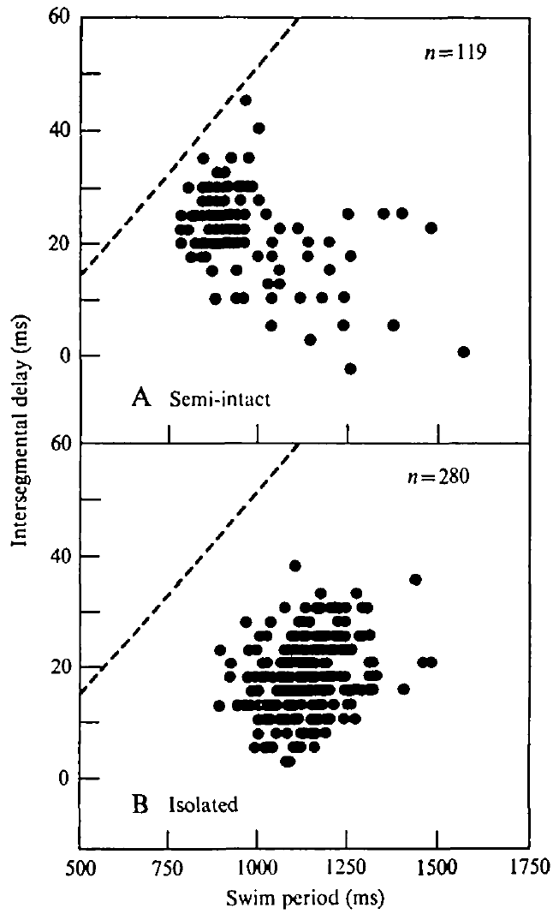
Central delays do not fully reproduce the intact wave
Intersegmental delay is the time separating equivalent activity in different segments. Kristan and Calabrese recorded homologous dorsal-excitor bursts from separated ganglia and expressed the resulting delay per segment. Posterior bursts generally followed anterior bursts, consistent with a rearward-moving motor pattern.
Delays in semi-intact and isolated cords were shorter than the delays inferred from intact swimming movements. The clear increase of intact movement delay with cycle period was absent in the reduced preparations. Their delay distributions remained variable despite a recognizable central rhythm.
Ashaber et al. (2021), Fig. 7(a). Reconstructed DE-3 arbor over a dorsal micro-CT image.
A chain of centrally coupled neurons can generate directional timing without recreating the complete intact body wave. In intact swimmers, delay grows with cycle period, keeping the phase lag per segment nearly constant. Kristan and Calabrese proposed that feedback matches delay to period so the body keeps the same shape at every swimming speed.
Kristan & Calabrese (1976), Fig. 6(A,B). Intersegmental motor-burst delay versus swim period.
Kristan & Calabrese (1976); Ashaber et al. (2021)
10
Notes:
Teaching transcript:
Intersegmental delay is the time separating equivalent activity in different segments. Kristan and Calabrese recorded homologous dorsal-excitor bursts from separated ganglia and expressed the resulting delay per segment. Posterior bursts generally followed anterior bursts, consistent with a rearward-moving motor pattern.
Delays in semi-intact and isolated cords were shorter than the delays inferred from intact swimming movements. The clear increase of intact movement delay with cycle period was absent in the reduced preparations. Their delay distributions remained variable despite a recognizable central rhythm.
A chain of centrally coupled neurons can generate directional timing without recreating the complete intact body wave. Peripheral feedback can adjust the relationship between propagation and period. The preparation comparison supports that contribution, but differences in movement and nerve-recording measures also limit a direct numerical equivalence.
In intact animals the traveling wave is measured through body movement; in the isolated cord it is measured through motor impulses. The study explicitly compares these related levels without treating their delays as automatically identical.
References:
W. B. Kristan Jr; R. L. Calabrese (1976). Rhythmic swimming activity in neurones of the isolated nerve cord of the leech. Journal of Experimental Biology 65(3):643–668. https://doi.org/10.1242/jeb.65.3.643
M. Ashaber; Y. Tomina; P. Kassraian; E. A. Bushong; W. B. Kristan Jr; M. H. Ellisman; D. A. Wagenaar (2021). Anatomy and activity patterns in a multifunctional motor neuron and its surrounding circuits. eLife 10:e61881. https://doi.org/10.7554/eLife.61881
Kristan & Calabrese (1976), Fig. 6(A,B). Intersegmental motor-burst delay versus swim period.
Figure source: https://doi.org/10.1242/jeb.65.3.643
Ashaber et al. (2021), Fig. 7(a). Reconstructed DE-3 arbor over a dorsal micro-CT image.
Figure source: https://doi.org/10.7554/eLife.61881

Slide 13
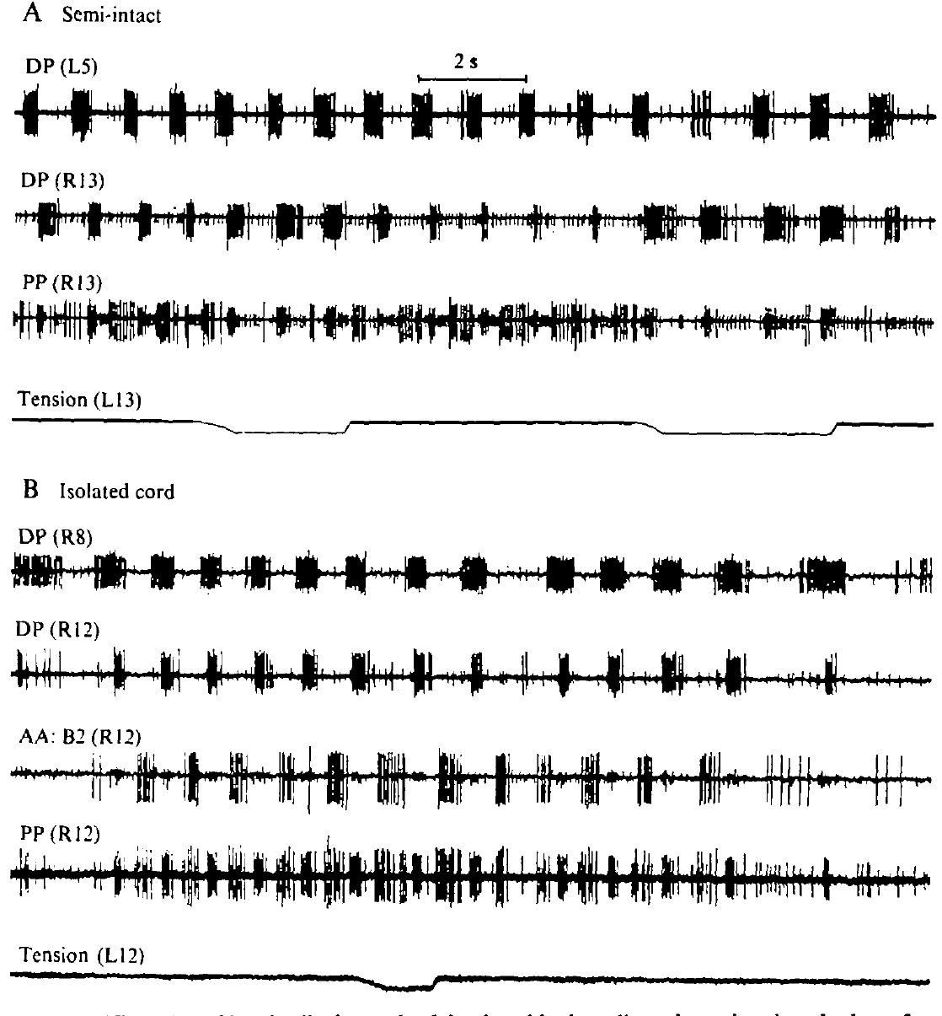
Stretch modifies bursts differently across preparations
Kristan and Calabrese attached a dorsal body-wall flap to a tension transducer and imposed longitudinal stretch during swimming activity. Sensory feedback is information generated by the body or environment that returns to the neural controller. Stretch provided a controlled perturbation rather than relying on spontaneous changes in movement.
In the semi-intact preparation, stretch prolonged dorsal-excitor bursts and shortened, or sometimes abolished, ventral-excitor bursts without changing the cycle period. In a nearly isolated preparation retaining one innervated segment, moderate stretch changed burst durations and could lengthen the overall period.
Ashaber et al. (2021), Fig. 7(a). Reconstructed DE-3 arbor over a dorsal micro-CT image.
Feedback can alter both the motor output and, under reduced conditions, the rhythm-generating network. Prolonging the dorsal-excitor burst when the dorsal wall is stretched works as a resistance reflex: the lengthened muscle receives more excitation and contracts against the imposed stretch.
Kristan & Calabrese (1976), Fig. 9(A,B). Body-wall stretch during semi-intact and nearly isolated rhythms.
Kristan & Calabrese (1976); Ashaber et al. (2021)
11
Notes:
Teaching transcript:
Kristan and Calabrese attached a dorsal body-wall flap to a tension transducer and imposed longitudinal stretch during swimming activity. Sensory feedback is information generated by the body or environment that returns to the neural controller. Stretch provided a controlled perturbation rather than relying on spontaneous changes in movement.
In the semi-intact preparation, stretch prolonged dorsal-excitor bursts and shortened, or sometimes abolished, ventral-excitor bursts without changing the cycle period. In a nearly isolated preparation retaining one innervated segment, moderate stretch changed burst durations and could lengthen the overall period.
Feedback can alter both the motor output and, under reduced conditions, the rhythm-generating network. The experiment does not establish one uniform effect of stretch under every condition. The remaining innervation and the extent of peripheral removal determine which feedback pathways can influence the rhythm.
A weak or moderate stretch and a strong stretch need not produce the same outcome. The source reports that stronger perturbations could stop the rhythm, so period lengthening is not an unrestricted linear rule.
References:
W. B. Kristan Jr; R. L. Calabrese (1976). Rhythmic swimming activity in neurones of the isolated nerve cord of the leech. Journal of Experimental Biology 65(3):643–668. https://doi.org/10.1242/jeb.65.3.643
M. Ashaber; Y. Tomina; P. Kassraian; E. A. Bushong; W. B. Kristan Jr; M. H. Ellisman; D. A. Wagenaar (2021). Anatomy and activity patterns in a multifunctional motor neuron and its surrounding circuits. eLife 10:e61881. https://doi.org/10.7554/eLife.61881
Kristan & Calabrese (1976), Fig. 9(A,B). Body-wall stretch during semi-intact and nearly isolated rhythms.
Figure source: https://doi.org/10.1242/jeb.65.3.643
Ashaber et al. (2021), Fig. 7(a). Reconstructed DE-3 arbor over a dorsal micro-CT image.
Figure source: https://doi.org/10.7554/eLife.61881

Slide 14
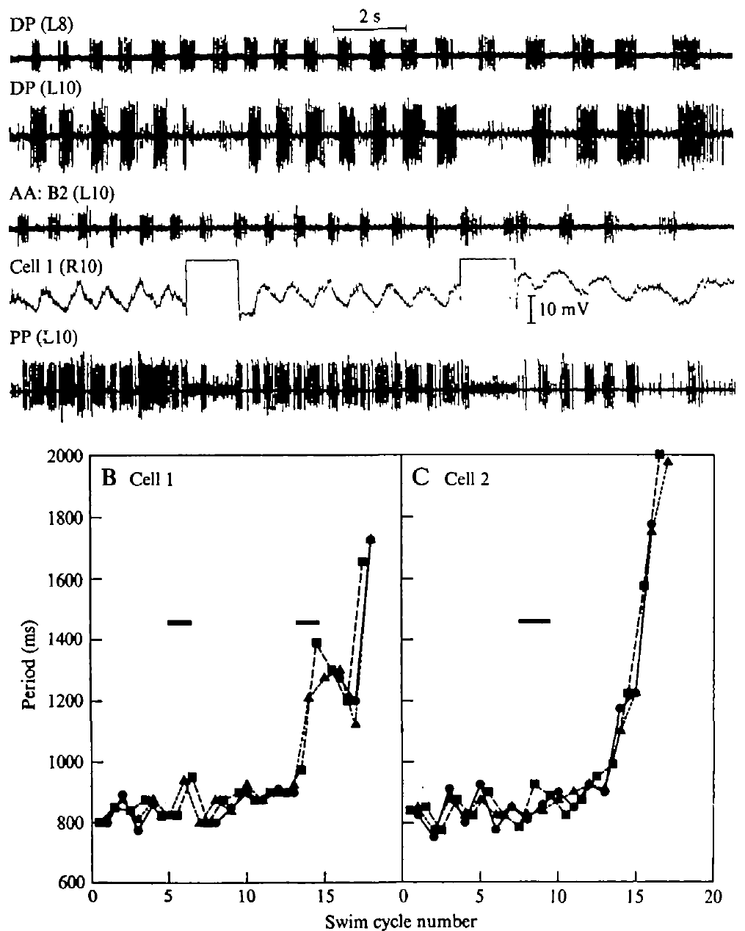
A dorsal inhibitor can slow the isolated swim rhythm
Kristan and Calabrese injected depolarizing current into identified motor neurons during an isolated-cord swim episode. Depolarization moves membrane voltage toward a less negative value and can increase firing. The dorsal inhibitor, cell 1, was stimulated strongly enough to suppress the associated dorsal excitor locally.
Cell 1 stimulation lengthened the period across the cord, including a recording two segments away. In one episode, the period increased from approximately 825 to 940 ms during the first current passage. Comparable stimulation of the ventral inhibitor, cell 2, did not produce the same period change.
Ashaber et al. (2021), Fig. 7(a). Reconstructed DE-3 arbor over a dorsal micro-CT image.
Cell 1 can influence the isolated oscillator, so a motor neuron is not only an output of the swim circuit but can also act back on rhythm generation. Stretching the body wall produced the same pattern of effects, suggesting that cell 1 and stretch input converge on a common route into the oscillator.
Kristan & Calabrese (1976), Fig. 8(A–C). Effects of current injection into identified inhibitory motor neurons.
Kristan & Calabrese (1976); Ashaber et al. (2021)
12
Notes:
Teaching transcript:
Kristan and Calabrese injected depolarizing current into identified motor neurons during an isolated-cord swim episode. Depolarization moves membrane voltage toward a less negative value and can increase firing. The dorsal inhibitor, cell 1, was stimulated strongly enough to suppress the associated dorsal excitor locally.
Cell 1 stimulation lengthened the period across the cord, including a recording two segments away. In one episode, the period increased from approximately 825 to 940 ms during the first current passage. Comparable stimulation of the ventral inhibitor, cell 2, did not produce the same period change.
The effect is specific evidence that cell 1 can influence the isolated oscillator, rather than proof that every motor neuron is a rhythm generator. The same manipulation did not reset period in the semi-intact preparation. Network state and peripheral input therefore constrain the behavioral significance of this feedback route.
An inhibitor can influence the motor pattern through more than its peripheral muscle connection. Current injection tests the functional effect of activating the identified cell; it does not by itself reveal all intervening synapses.
References:
W. B. Kristan Jr; R. L. Calabrese (1976). Rhythmic swimming activity in neurones of the isolated nerve cord of the leech. Journal of Experimental Biology 65(3):643–668. https://doi.org/10.1242/jeb.65.3.643
M. Ashaber; Y. Tomina; P. Kassraian; E. A. Bushong; W. B. Kristan Jr; M. H. Ellisman; D. A. Wagenaar (2021). Anatomy and activity patterns in a multifunctional motor neuron and its surrounding circuits. eLife 10:e61881. https://doi.org/10.7554/eLife.61881
Kristan & Calabrese (1976), Fig. 8(A–C). Effects of current injection into identified inhibitory motor neurons.
Figure source: https://doi.org/10.1242/jeb.65.3.643
Ashaber et al. (2021), Fig. 7(a). Reconstructed DE-3 arbor over a dorsal micro-CT image.
Figure source: https://doi.org/10.7554/eLife.61881

Slide 15
Stepwise reduction assigns each swim feature to its source
Kristan and Calabrese compared intact swimmers, semi-intact animals, cords keeping one innervated segment, and fully isolated cords. Each level removes more sensory input while the recording method stays constant, so a feature lost at one level depends on what that level removed.
Alternating dorsal and ventral bursts survive every reduction and therefore come from the cord. Scaling of intersegmental delay with period is gone once the body is opened, so it needs the whole moving animal. Dorsal-ventral phasing shifts only after full isolation, pointing to input from the remaining body wall.
With many segments attached, stretch or cell 1 stimulation reshapes bursts locally; with one segment left, the same input resets the period of the entire cord. Input from many segments thus holds the shared rhythm steady, and a stripped-down oscillator follows any single input.
Kristan & Calabrese (1976), Fig. 9(A,B). Body-wall stretch during semi-intact and nearly isolated rhythms.
Kristan & Calabrese (1976)
12a
Notes:
Slides 6 to 12 each compare two preparations; lined up together, they form a ladder of reduction that sorts the swim pattern into central and sensory components.
The design holds measurement constant and varies the body.
Kristan and Calabrese recorded motor nerves at every level, from the semi-intact animal down to the completely isolated cord, and compared them with movements of intact swimmers.
Changes between levels can then be attributed to the tissue removed rather than to a different way of measuring.
Each feature has a level where it disappears.
The alternating rhythm on slides 6 and 7 never disappears, the period dependence of intersegmental delay on slide 10 is missing from both reduced preparations, and the phase relations on slide 9 differ between semi-intact and isolated cords.
The authors conclude that sensory input determines dorsal-ventral phasing and matches delay to period.
Perturbations reveal a stabilizing role.
Stretch on slide 11 and cell 1 stimulation on slide 12 change only burst durations in the semi-intact preparation but change the period of the whole cord when little periphery remains.
Kristan and Calabrese interpret this as sensory input stabilizing the centrally generated rhythm.
References:
W. B. Kristan Jr; R. L. Calabrese (1976). Rhythmic swimming activity in neurones of the isolated nerve cord of the leech. Journal of Experimental Biology 65(3):643–668. https://doi.org/10.1242/jeb.65.3.643

Slide 16
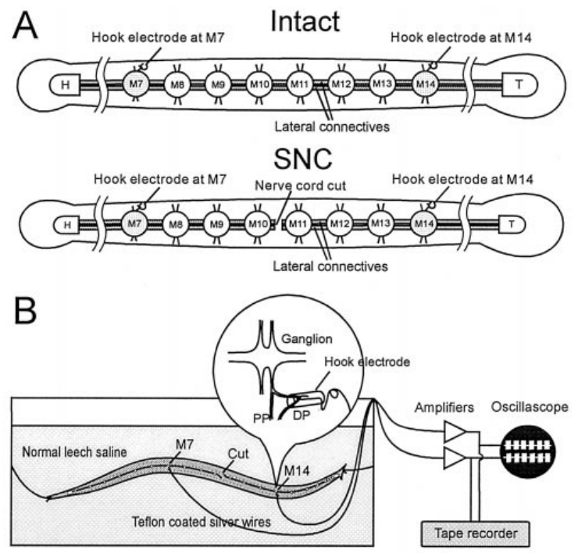
Implanted electrodes connect swim impulses to movement
Yu and colleagues implanted hook electrodes on dorsal posterior nerves in leeches whose bodies could still move. The largest motor unit in these nerves was used to monitor the dorsal excitor DE-3. Video and electrical recordings linked the progression of the body wave with activity on either side of a central cord transection.
The cord was cut between midbody ganglia M10 and M11. Recording sites at M7 and M14 bracketed the interruption. Intact preparations and preparations with a severed cord provided the critical comparison while retaining peripheral muscles and sensory receptors.
Ashaber et al. (2021), Fig. 7(a). Reconstructed DE-3 arbor over a dorsal micro-CT image.
This design tests whether coordination can cross a central interruption through routes associated with the moving body. Earlier work had concluded that sensory feedback could not coordinate leech swimming; recording motor neurons in animals still able to swim put that conclusion to a direct test.
Yu et al. (1999), Fig. 2(A,B). Original recording preparation and implanted-electrode experiment.
Yu et al. (1999); Ashaber et al. (2021)
13
Notes:
Teaching transcript:
Yu and colleagues implanted hook electrodes on dorsal posterior nerves in leeches whose bodies could still move. The largest motor unit in these nerves was used to monitor the dorsal excitor DE-3. Video and electrical recordings linked the progression of the body wave with activity on either side of a central cord transection.
The cord was cut between midbody ganglia M10 and M11. Recording sites at M7 and M14 bracketed the interruption. Intact preparations and preparations with a severed cord provided the critical comparison while retaining peripheral muscles and sensory receptors.
This design tests whether coordination can cross a central interruption through routes associated with the moving body. It does not isolate one stretch receptor or one reflex pathway. The implanted signals provide direct motor timing while the behavioral records establish whether the body remained coordinated.
A transection is a surgical cut through a neural pathway. The lesion severed the connecting nerve cord while leaving the surrounding body continuous, which differs fundamentally from separating the animal into two physical halves.
References:
X. Yu; B. Nguyen; W. O. Friesen (1999). Sensory feedback can coordinate the swimming activity of the leech. Journal of Neuroscience 19(11):4634–4643. https://doi.org/10.1523/JNEUROSCI.19-11-04634.1999
M. Ashaber; Y. Tomina; P. Kassraian; E. A. Bushong; W. B. Kristan Jr; M. H. Ellisman; D. A. Wagenaar (2021). Anatomy and activity patterns in a multifunctional motor neuron and its surrounding circuits. eLife 10:e61881. https://doi.org/10.7554/eLife.61881
Yu et al. (1999), Fig. 2(A,B). Original recording preparation and implanted-electrode experiment.
Figure source: https://doi.org/10.1523/JNEUROSCI.19-11-04634.1999
Ashaber et al. (2021), Fig. 7(a). Reconstructed DE-3 arbor over a dorsal micro-CT image.
Figure source: https://doi.org/10.7554/eLife.61881

Slide 17
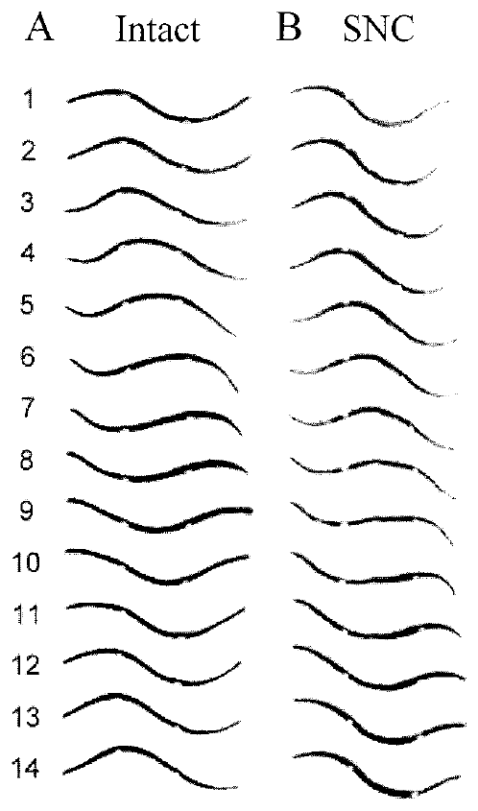
Body continuity permits swimming after cord transection
Yu and colleagues videotaped the same leeches before and after cutting the nerve cord between M10 and M11. Beads placed at M7 and M14 allowed timing of troughs and crests at defined body locations. Unimplanted controls and animals with beads helped separate surgery effects from effects of the movement markers.
The severed-cord animals could retain a rearward-progressing body wave spanning the lesion. Their phase lag between M7 and M14 increased from roughly 147° before the cut to roughly 170° afterward. They also swam more slowly, so persistence of coordination did not mean normal performance was fully preserved.
A continuous body provides a route through which movement-dependent feedback can coordinate separated central regions. When the investigators later cut the animals into anterior and posterior halves, the coordinated wave disappeared, so the shared body carried the coupling.
Yu et al. (1999), Fig. 3(A,B). Measured body-wave sequences before and after a central cut.
Yu et al. (1999)
14
Notes:
Teaching transcript:
Yu and colleagues videotaped the same leeches before and after cutting the nerve cord between M10 and M11. Beads placed at M7 and M14 allowed timing of troughs and crests at defined body locations. Unimplanted controls and animals with beads helped separate surgery effects from effects of the movement markers.
The severed-cord animals could retain a rearward-progressing body wave spanning the lesion. Their phase lag between M7 and M14 increased from roughly 147° before the cut to roughly 170° afterward. They also swam more slowly, so persistence of coordination did not mean normal performance was fully preserved.
A continuous body provides a route through which movement-dependent feedback can coordinate separated central regions. The result supports peripheral coordination when direct central communication is interrupted. It does not imply that the intact animal normally dispenses with central intersegmental connections.
The investigators later cut the animals physically into anterior and posterior halves. Those halves lacked the coordinated whole-body wave, strengthening the interpretation that continuity of the peripheral body matters after the neural lesion.
References:
X. Yu; B. Nguyen; W. O. Friesen (1999). Sensory feedback can coordinate the swimming activity of the leech. Journal of Neuroscience 19(11):4634–4643. https://doi.org/10.1523/JNEUROSCI.19-11-04634.1999
Yu et al. (1999), Fig. 3(A,B). Measured body-wave sequences before and after a central cut.
Figure source: https://doi.org/10.1523/JNEUROSCI.19-11-04634.1999

Slide 18
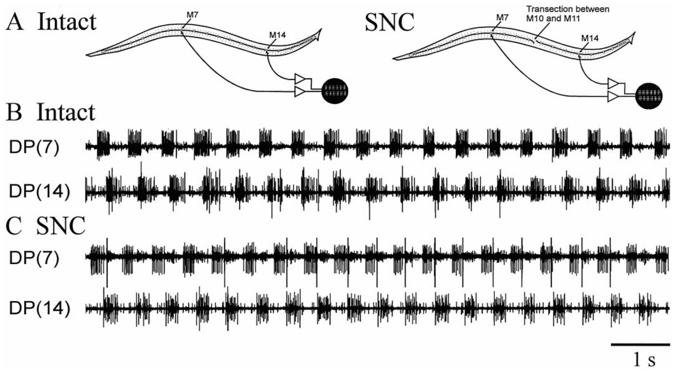
Motor recordings confirm coordination across the lesion
Yu and colleagues compared DE-3 burst timing at M7 and M14 while the body moved. This electrical measurement tested whether apparent coordination in video corresponded to coordinated neural output. The same implanted sites could be examined before and after the midbody nerve cord was cut.
Motor bursts remained phase related across the cut while the animal expressed coordinated swimming. The lag was larger and more variable than in intact preparations. Isolated cords whose direct intersegmental connections were severed lacked the comparable coordination available when the body was present.
Yu et al. (1999), Fig. 6(A–C). In situ motor-nerve records in intact and severed-cord leeches.
The combined electrical and behavioral evidence supports feedback-dependent coupling between disconnected central regions. Yu and colleagues concluded that sensory feedback alone can coordinate swimming. Each cord region still generates its own rhythm, while signals returning from the moving body align the regions with one another.
Ashaber et al. (2021), Fig. 7(a). Reconstructed DE-3 arbor over a dorsal micro-CT image.
Yu et al. (1999); Ashaber et al. (2021)
15
Notes:
Teaching transcript:
Yu and colleagues compared DE-3 burst timing at M7 and M14 while the body moved. This electrical measurement tested whether apparent coordination in video corresponded to coordinated neural output. The same implanted sites could be examined before and after the midbody nerve cord was cut.
Motor bursts remained phase related across the cut while the animal expressed coordinated swimming. The lag was larger and more variable than in intact preparations. Isolated cords whose direct intersegmental connections were severed lacked the comparable coordination available when the body was present.
The combined electrical and behavioral evidence supports feedback-dependent coupling between disconnected central regions. It does not establish that muscles alone transmit the signal without sensory neurons. The relevant peripheral route includes body mechanics and the return of movement-related information to each remaining neural circuit.
A motor rhythm can remain centrally generated within each cord region while sensory signals coordinate the regions. Central generation and feedback-dependent coordination are compatible properties of the same behavior.
References:
X. Yu; B. Nguyen; W. O. Friesen (1999). Sensory feedback can coordinate the swimming activity of the leech. Journal of Neuroscience 19(11):4634–4643. https://doi.org/10.1523/JNEUROSCI.19-11-04634.1999
M. Ashaber; Y. Tomina; P. Kassraian; E. A. Bushong; W. B. Kristan Jr; M. H. Ellisman; D. A. Wagenaar (2021). Anatomy and activity patterns in a multifunctional motor neuron and its surrounding circuits. eLife 10:e61881. https://doi.org/10.7554/eLife.61881
Yu et al. (1999), Fig. 6(A–C). In situ motor-nerve records in intact and severed-cord leeches.
Figure source: https://doi.org/10.1523/JNEUROSCI.19-11-04634.1999
Ashaber et al. (2021), Fig. 7(a). Reconstructed DE-3 arbor over a dorsal micro-CT image.
Figure source: https://doi.org/10.7554/eLife.61881

Slide 19
Two coupling routes make segment coordination redundant
Removing nerve roots from crawling leeches kept the wave orderly across the operated region, so central connections sufficed. Cutting the cord of swimming leeches kept the wave running across the cut, so the moving body sufficed.
Coordination of this kind is redundant: more than one pathway can carry the same coordinating signal, so losing one weakens performance without abolishing the behavior. The lesioned swimmers match that description: their wave crossed the cut, but with a larger, more variable lag between segments and slower swimming.
Redundant coupling protects the animal. A leech with a damaged cord can still swim, and segments that lose their sensory roots still crawl in sequence. In the intact leech the routes work together: the isolated cord fails to scale intersegmental delay with period, while feedback alone gives slower, looser coordination than the two combined.
Yu et al. (1999), Fig. 3(A,B). Measured body-wave sequences before and after a central cut.
Cacciatore et al. (2000); Yu et al. (1999)
15a
Notes:
Slide 5 for crawling and slides 13 to 15 for swimming each cut one link between segments; placed side by side, they show two sufficient routes rather than one essential route.
The lesions spared opposite routes.
Cacciatore and colleagues cut peripheral roots in segments 7 to 12 and left the connectives; Yu and colleagues cut the connectives between M10 and M11 and left the body continuous.
Each surgery therefore tested whether the spared route could coordinate segments without the other.
Sufficiency of each route implies redundancy.
Yu and colleagues conclude that intersegmental coordination can be achieved by sensory feedback alone, without the interactions conveyed by the nerve cord.
The cost of relying on one route shows up as a phase lag that grew from about 147 to about 170 degrees and a slower swim.
Each route also supplies something the other lacks.
Kristan and Calabrese found that delay scaling with period, a feature of intact swimming, is missing from reduced cords, which points to the periphery for that adjustment.
Central connections, for their part, deliver tighter and faster coupling than the body can provide.
References:
X. Yu; B. Nguyen; W. O. Friesen (1999). Sensory feedback can coordinate the swimming activity of the leech. Journal of Neuroscience 19(11):4634–4643. https://doi.org/10.1523/JNEUROSCI.19-11-04634.1999
T. W. Cacciatore; R. Rozenshteyn; W. B. Kristan Jr (2000). Kinematics and modeling of leech crawling: evidence for an oscillatory behavior produced by propagating waves of excitation. Journal of Neuroscience 20(4):1643–1655. https://doi.org/10.1523/JNEUROSCI.20-04-01643.2000
W. B. Kristan Jr; R. L. Calabrese (1976). Rhythmic swimming activity in neurones of the isolated nerve cord of the leech. Journal of Experimental Biology 65(3):643–668. https://doi.org/10.1242/jeb.65.3.643

Slide 20
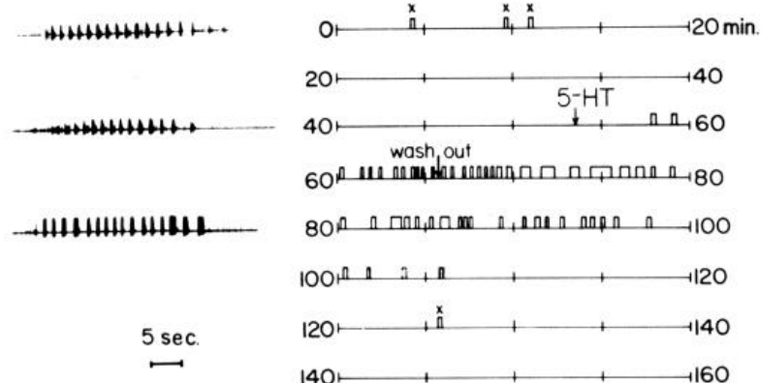
Serotonin increases the availability of the swim program
Serotonin, also called 5-hydroxytryptamine or 5-HT, is a neurotransmitter that can modulate circuit activity. Willard applied serotonin to isolated leech nerve cords and monitored swim bursts in motor nerves. This preparation tested a neural effect without requiring a moving body.
Serotonin promoted repeated swimming episodes without additional electrical stimulation and increased responses to stimuli that previously evoked only one episode. Approximately 0.5–10 μM induced spontaneous swimming; concentrations as low as 50 nM elicited additional episodes after stimulation. Exposure and washout separated the drug effect from baseline excitability.
Willard (1981), Fig. 1. Swim episodes before, during and after serotonin exposure.
Serotonin changes the likelihood that a patterned program is expressed, rather than supplying a sequence of timed muscle commands. The central circuit still supplies the rhythm once the modulated state permits its expression. A leech with more serotonin acting on its cord is therefore readier to swim when stimulated.
Ashaber et al. (2021), Fig. 7(a). Reconstructed DE-3 arbor over a dorsal micro-CT image.
Willard (1981); Ashaber et al. (2021)
16
Notes:
Teaching transcript:
Serotonin, also called 5-hydroxytryptamine or 5-HT, is a neurotransmitter that can modulate circuit activity. Willard applied serotonin to isolated leech nerve cords and monitored swim bursts in motor nerves. This preparation tested a neural effect without requiring a moving body.
Serotonin promoted repeated swimming episodes without additional electrical stimulation and increased responses to stimuli that previously evoked only one episode. Approximately 0.5–10 μM induced spontaneous swimming; concentrations as low as 50 nM elicited additional episodes after stimulation. Exposure and washout separated the drug effect from baseline excitability.
Serotonin changes the likelihood that a patterned program is expressed, rather than supplying a sequence of timed muscle commands. This pharmacology does not establish a particular serotonin receptor subtype or ion-channel target. The central circuit still supplies the rhythm once the modulated state permits its expression.
A neuromodulator changes the operation of a circuit over a broader interval than a single precisely timed synaptic event. The observation concerns access to the swim pattern and should not be converted into an unsupported molecular receptor assignment.
References:
A. L. Willard (1981). Effects of serotonin on the generation of the motor program for swimming by the medicinal leech. Journal of Neuroscience 1(9):936–944. https://doi.org/10.1523/JNEUROSCI.01-09-00936.1981
M. Ashaber; Y. Tomina; P. Kassraian; E. A. Bushong; W. B. Kristan Jr; M. H. Ellisman; D. A. Wagenaar (2021). Anatomy and activity patterns in a multifunctional motor neuron and its surrounding circuits. eLife 10:e61881. https://doi.org/10.7554/eLife.61881
Willard (1981), Fig. 1. Swim episodes before, during and after serotonin exposure.
Figure source: https://doi.org/10.1523/JNEUROSCI.01-09-00936.1981
Ashaber et al. (2021), Fig. 7(a). Reconstructed DE-3 arbor over a dorsal micro-CT image.
Figure source: https://doi.org/10.7554/eLife.61881

Slide 21
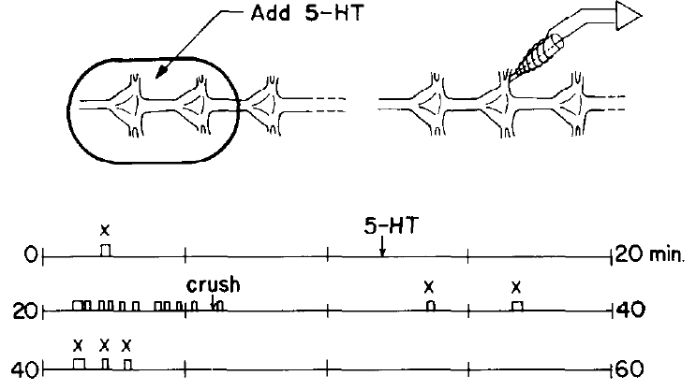
Serotonin can act on a restricted region of the cord
Willard placed a barrier around two ganglia and applied serotonin only to that region of an isolated cord. Peripheral tissue was absent, and the remainder of the cord was maintained in normal saline. This localized exposure tested whether the drug had to reach every segment directly.
After serotonin reached the restricted chamber, the larger cord could generate swimming episodes. Crushing connectives between the exposed region and the remaining cord interrupted the relevant communication. The exposed region could therefore influence distant parts through connections along the central nervous system.
A local modulatory action can recruit a distributed motor circuit. Raising serotonin in only part of the cord was enough to put the whole swim system into an active state, so modulation need not reach every ganglion directly for the animal to swim.
Willard (1981), Fig. 3. Restricted serotonin application and cord-disconnection tests.
Ashaber et al. (2021), Fig. 7(a). Reconstructed DE-3 arbor over a dorsal micro-CT image.
Willard (1981); Ashaber et al. (2021)
17
Notes:
Teaching transcript:
Willard placed a barrier around two ganglia and applied serotonin only to that region of an isolated cord. Peripheral tissue was absent, and the remainder of the cord was maintained in normal saline. This localized exposure tested whether the drug had to reach every segment directly.
After serotonin reached the restricted chamber, the larger cord could generate swimming episodes. Crushing connectives between the exposed region and the remaining cord interrupted the relevant communication. The exposed region could therefore influence distant parts through connections along the central nervous system.
A local modulatory action can recruit a distributed motor circuit. The experiment does not establish that the two exposed ganglia contain the sole rhythm-generating kernel. The effect depends on their access to other ganglia, and crushing a connective interrupts many axons rather than a single identified pathway.
The preparation separates the site of chemical exposure from the site of distributed motor expression. Keeping the bathing solutions separate made this a test of communication along the cord rather than simple drug diffusion throughout the dish.
References:
A. L. Willard (1981). Effects of serotonin on the generation of the motor program for swimming by the medicinal leech. Journal of Neuroscience 1(9):936–944. https://doi.org/10.1523/JNEUROSCI.01-09-00936.1981
M. Ashaber; Y. Tomina; P. Kassraian; E. A. Bushong; W. B. Kristan Jr; M. H. Ellisman; D. A. Wagenaar (2021). Anatomy and activity patterns in a multifunctional motor neuron and its surrounding circuits. eLife 10:e61881. https://doi.org/10.7554/eLife.61881
Willard (1981), Fig. 3. Restricted serotonin application and cord-disconnection tests.
Figure source: https://doi.org/10.1523/JNEUROSCI.01-09-00936.1981
Ashaber et al. (2021), Fig. 7(a). Reconstructed DE-3 arbor over a dorsal micro-CT image.
Figure source: https://doi.org/10.7554/eLife.61881

Slide 22
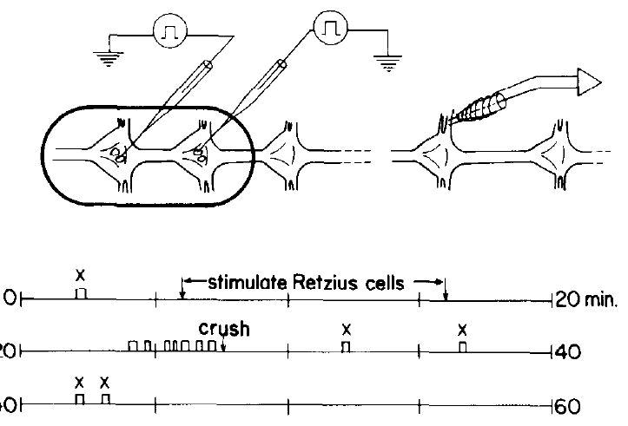
Retzius-cell stimulation releases an effective modulator
Willard stimulated identified Retzius neurons, serotonin-containing cells in leech ganglia, while recording the swim program. A small chamber confined the saline around the stimulated cells. This design tested whether neuronal release could reproduce the effect of bath-applied serotonin.
Stimulation evoked swimming when the surrounding volume was small, less than approximately 50 μl. Serotonin was detected in the bathing solution after stimulation. Larger surrounding volumes did not provide the same reliable effect, consistent with dilution of a released substance.
The results link an identified serotonergic source with circuit modulation and chemical release. Willard also found serotonin in the blood sinus surrounding the cord, so serotonin can reach swim circuits both from nearby Retzius terminals and as a circulating signal.
Willard (1981), Fig. 4. Retzius stimulation in a small chamber and resulting swim episodes.
Ashaber et al. (2021), Fig. 7(a). Reconstructed DE-3 arbor over a dorsal micro-CT image.
Willard (1981); Ashaber et al. (2021)
18
Notes:
Teaching transcript:
Willard stimulated identified Retzius neurons, serotonin-containing cells in leech ganglia, while recording the swim program. A small chamber confined the saline around the stimulated cells. This design tested whether neuronal release could reproduce the effect of bath-applied serotonin.
Stimulation evoked swimming when the surrounding volume was small, less than approximately 50 μl. Serotonin was detected in the bathing solution after stimulation. Larger surrounding volumes did not provide the same reliable effect, consistent with dilution of a released substance.
The results link an identified serotonergic source with circuit modulation and chemical release. They do not prove that Retzius cells provide all serotonin acting during intact swimming. Willard also found serotonin in the blood sinus surrounding the cord, indicating that neuronal and circulating access must be distinguished.
The source used biochemical purification followed by a calibrated snail-heart bioassay to detect serotonin. Detecting released substance supplies evidence beyond simply observing that current injection into a cell altered motor output.
References:
A. L. Willard (1981). Effects of serotonin on the generation of the motor program for swimming by the medicinal leech. Journal of Neuroscience 1(9):936–944. https://doi.org/10.1523/JNEUROSCI.01-09-00936.1981
M. Ashaber; Y. Tomina; P. Kassraian; E. A. Bushong; W. B. Kristan Jr; M. H. Ellisman; D. A. Wagenaar (2021). Anatomy and activity patterns in a multifunctional motor neuron and its surrounding circuits. eLife 10:e61881. https://doi.org/10.7554/eLife.61881
Willard (1981), Fig. 4. Retzius stimulation in a small chamber and resulting swim episodes.
Figure source: https://doi.org/10.1523/JNEUROSCI.01-09-00936.1981
Ashaber et al. (2021), Fig. 7(a). Reconstructed DE-3 arbor over a dorsal micro-CT image.
Figure source: https://doi.org/10.7554/eLife.61881

Slide 23
Serotonin acts as a slow state signal, not a swim command
Fast transmission carries a timed message between neurons within milliseconds. Neuromodulation instead changes how neurons respond, over seconds to minutes, by altering membrane and synaptic properties. Serotonin's effects on the leech cord belong to the second category: swimming became more likely and more persistent, while cycle timing still came from the swim generator.
Release from Retzius cells worked only when it could accumulate in a small volume, and exposing two ganglia altered activity throughout the cord, both features of a chemical that builds up and spreads rather than a signal aimed at single targets.
Willard (1981), Fig. 4. Retzius stimulation in a small chamber and resulting swim episodes.
Serotonin in the blood sinus adds a hormone-like route that reaches every ganglion at once. Release from Retzius cells and circulating serotonin can therefore raise the readiness of the entire swim system together, so a stimulus that once evoked a single episode now evokes several.
Willard (1981)
18a
Notes:
Slides 16 to 18 present three serotonin experiments; the distinction between transmission and modulation ties them into one picture of what serotonin does to the swim system.
Two timescales of chemical signaling.
A transmitter that opens ion channels directly produces a postsynaptic response that starts and ends within milliseconds of each spike.
A modulator alters properties such as excitability and synaptic strength, so its influence outlasts any single spike and spans many cycles of a rhythm.
The serotonin experiments carry the signature of modulation.
On slide 16, spontaneous swimming and extra episodes appeared under serotonin and disappeared after washout, without serotonin specifying when each burst occurred.
Slides 17 and 18 add that a restricted exposure and release into a small chamber were both enough to change the behavior of the cord.
Two delivery routes converge on one effect.
Willard detected serotonin in the bathing solution after Retzius stimulation and also in the blood sinus surrounding the cord.
Local release and circulation can both raise serotonin around the ganglia, shifting the whole cord toward expressing the swim program.
References:
A. L. Willard (1981). Effects of serotonin on the generation of the motor program for swimming by the medicinal leech. Journal of Neuroscience 1(9):936–944. https://doi.org/10.1523/JNEUROSCI.01-09-00936.1981

Slide 24
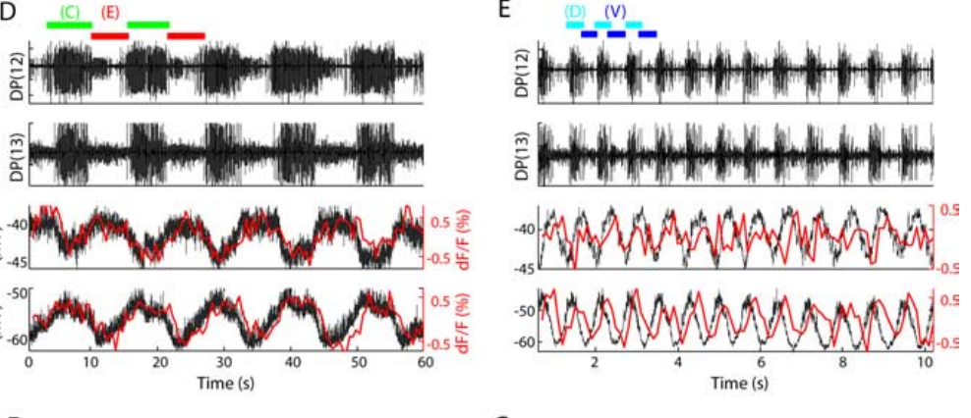
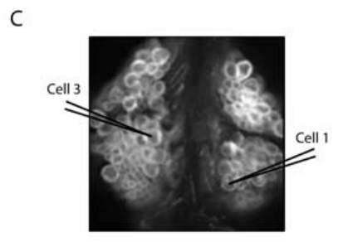
Voltage-sensitive imaging captures two rhythms in one cord
A voltage-sensitive dye changes its optical signal with membrane voltage. Briggman and Kristan imaged an exposed segmental ganglion while eliciting swimming and crawling in the same isolated cord. Intracellular recordings from cells 1 and 3 checked whether the optical signals tracked the identified neurons.
Optical and electrical records preserved the different rhythms and phase relationships. Cell 1 and cell 3 oscillated approximately 180° apart during crawling but approximately 90° apart during swimming. Example frequencies were 0.09 Hz for crawling and 1.3 Hz for swimming.
The calibration supports interpreting optical fluctuations as neuronal activity rather than assuming every fluorescence change is a spike. Dye in every cell body allowed Briggman and Kristan to record from about 80% of the roughly 400 neurons in the ganglion, so participation in both rhythms could be measured across a whole population at once.
Briggman & Kristan (2006), Fig. 1(D,E). Simultaneous optical and intracellular motor-cell signals.
Briggman & Kristan (2006), Fig. 1(C). Dorsal ganglion surface with identified recording cells.
Briggman & Kristan (2006)
19
Notes:
Teaching transcript:
A voltage-sensitive dye changes its optical signal with membrane voltage. Briggman and Kristan imaged an exposed segmental ganglion while eliciting swimming and crawling in the same isolated cord. Intracellular recordings from cells 1 and 3 checked whether the optical signals tracked the identified neurons.
Optical and electrical records preserved the different rhythms and phase relationships. Cell 1 and cell 3 oscillated approximately 180° apart during crawling but approximately 90° apart during swimming. Example frequencies were 0.09 Hz for crawling and 1.3 Hz for swimming.
The calibration supports interpreting optical fluctuations as neuronal activity rather than assuming every fluorescence change is a spike. Dye kinetics introduce a temporal lag, and the optical sampling was slower than the electrical recording. Phase-associated imaging is therefore evidence about population dynamics, not a substitute for every intracellular waveform.
The investigators acquired swimming images at 20 frames per second and formed ratioed signals at 10 Hz. Crawling was slower and could be sampled less frequently. Simultaneous electrical records supplied the faster reference.
References:
K. L. Briggman; W. B. Kristan Jr (2006). Imaging dedicated and multifunctional neural circuits generating distinct behaviors. Journal of Neuroscience 26(42):10925–10933. https://doi.org/10.1523/JNEUROSCI.3265-06.2006
Briggman & Kristan (2006), Fig. 1(D,E). Simultaneous optical and intracellular motor-cell signals.
Figure source: https://doi.org/10.1523/JNEUROSCI.3265-06.2006
Briggman & Kristan (2006), Fig. 1(C). Dorsal ganglion surface with identified recording cells.
Figure source: https://doi.org/10.1523/JNEUROSCI.3265-06.2006

Slide 25
Voltage imaging records inhibition that calcium imaging misses
Calcium indicators brighten mainly when spikes open voltage-gated calcium channels, so they register firing but miss small depolarizations and hyperpolarizations. A voltage-sensitive dye sits in the membrane and responds to voltage itself, reporting subthreshold excitation and inhibition as well as spikes.
Cell 257 was strongly hyperpolarized during swimming, and the inhibitors DI-1 and VI-2 were suppressed while DE-3 fired; such events involve no spikes, and a calcium signal would read them as silence.
Briggman & Kristan (2006), Fig. 1(D,E). Simultaneous optical and intracellular motor-cell signals.
Voltage dyes follow membrane changes faster than calcium signals rise and decay, so they can resolve phase within a swim cycle lasting about a second. Ashaber and colleagues imaged both surfaces of a ganglion at once with a double-sided microscope and recorded 250 neurons simultaneously.
Briggman & Kristan (2006); Ashaber et al. (2021)
19a
Notes:
Slide 19 calibrates the voltage-sensitive dye against intracellular recordings; the reason this dye, rather than a calcium indicator, was used explains what the later phase maps could capture.
Calcium and voltage report different events.
Calcium entry is tied mostly to action potentials, so a calcium indicator is a spike detector with slow kinetics.
Ashaber and colleagues chose a fast voltage dye because it captures both excitatory and inhibitory synaptic potentials that calcium imaging could not detect.
Inhibition is central to the leech patterns.
The hyperpolarization of cell 257 on slide 25 and the suppression of inhibitory motor neurons during DE-3 bursts on slides 29 and 36 are all subthreshold events.
Coherence and phase on slide 20 depend on following each cell's voltage through the whole cycle, including its inhibited phase.
Coverage and speed made population maps possible.
Briggman and Kristan recorded from about 80 percent of the roughly 400 neurons of a ganglion, which is how they counted swim and crawl participants.
The later double-sided imaging reached 250 neurons in one run, matching the scale of the earlier study.
References:
K. L. Briggman; W. B. Kristan Jr (2006). Imaging dedicated and multifunctional neural circuits generating distinct behaviors. Journal of Neuroscience 26(42):10925–10933. https://doi.org/10.1523/JNEUROSCI.3265-06.2006
M. Ashaber; Y. Tomina; P. Kassraian; E. A. Bushong; W. B. Kristan Jr; M. H. Ellisman; D. A. Wagenaar (2021). Anatomy and activity patterns in a multifunctional motor neuron and its surrounding circuits. eLife 10:e61881. https://doi.org/10.7554/eLife.61881

Slide 26
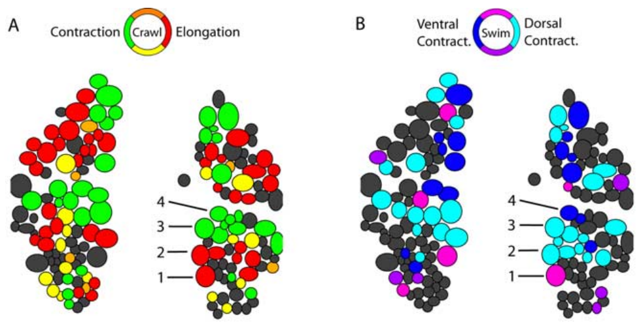
Dorsal neurons change their phase across behaviors
Briggman and Kristan calculated the phase of each optically recorded cell relative to a reference motor neuron. Coherence measures how consistently two signals share an oscillation at a specified frequency. Cells that oscillated consistently could be assigned a phase within the corresponding motor cycle.
The dorsal ganglion contained cells active during both rhythms, but their phases were reorganized. The relationship between longitudinal excitors and inhibitors differed because swimming alternates dorsal and ventral contraction whereas crawling coactivates longitudinal muscle groups during shortening. The measured phase maps came from the same preparation.
A cell’s participation in both rhythms is compatible with a different functional role in each. A neuron whose phase relative to the reference motor neuron moves between behaviors has changed its timing partners, the signature of a reconfigured circuit.
Briggman & Kristan (2006), Fig. 2(A,B). Measured dorsal-surface phase maps for crawling and swimming.
Briggman & Kristan (2006)
20
Notes:
Teaching transcript:
Briggman and Kristan calculated the phase of each optically recorded cell relative to a reference motor neuron. Coherence measures how consistently two signals share an oscillation at a specified frequency. Cells that oscillated consistently could be assigned a phase within the corresponding motor cycle.
The dorsal ganglion contained cells active during both rhythms, but their phases were reorganized. The relationship between longitudinal excitors and inhibitors differed because swimming alternates dorsal and ventral contraction whereas crawling coactivates longitudinal muscle groups during shortening. The measured phase maps came from the same preparation.
A cell’s participation in both rhythms does not imply that it serves the same functional role in each. Phase maps constrain which neurons are candidates for shared circuitry. They do not establish the direction or transmitter of a connection, which requires additional anatomical or physiological evidence.
The displayed panels are the measured maps. The paper also contains predicted maps based on previously known motor functions, but predicted and recorded activity are different kinds of evidence and are kept separate.
References:
K. L. Briggman; W. B. Kristan Jr (2006). Imaging dedicated and multifunctional neural circuits generating distinct behaviors. Journal of Neuroscience 26(42):10925–10933. https://doi.org/10.1523/JNEUROSCI.3265-06.2006
Briggman & Kristan (2006), Fig. 2(A,B). Measured dorsal-surface phase maps for crawling and swimming.
Figure source: https://doi.org/10.1523/JNEUROSCI.3265-06.2006

Slide 27
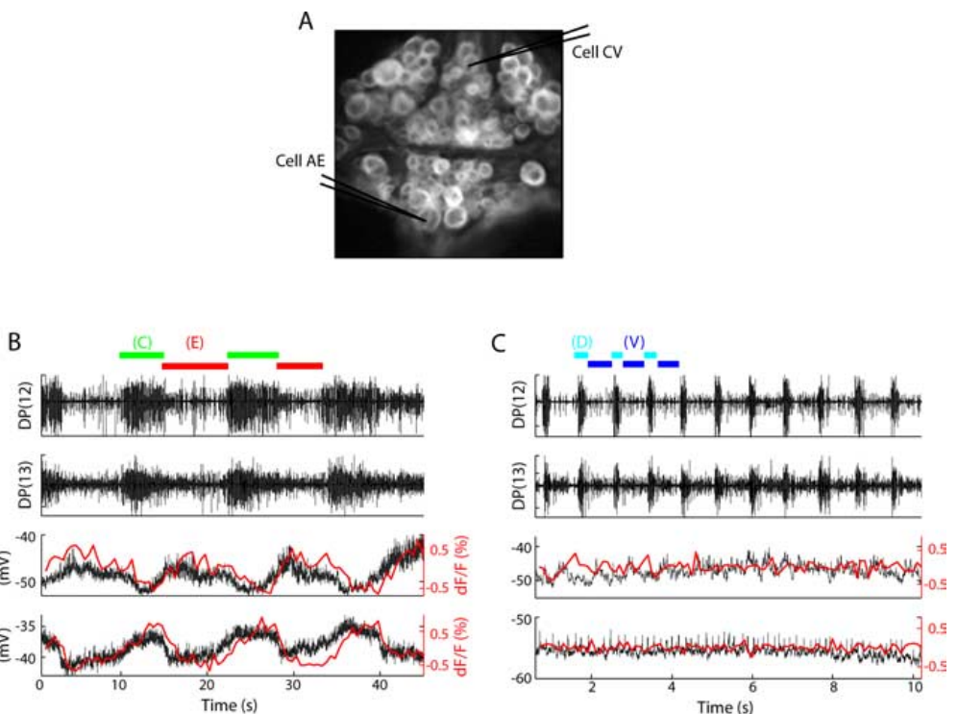
Circular-muscle cells participate selectively in crawling
Briggman and Kristan recorded the ventral ganglion surface and simultaneously impaled cells CV and AE. CV is a circular-muscle excitor associated with body elongation. AE, the annulus erector motor neuron, provides a recognizable output associated with crawling and changes in body form.
CV and AE oscillated approximately 180° apart during crawling. Neither displayed the corresponding rhythmic oscillation during swimming in the same preparation. The optical and intracellular records agreed on this distinction, providing a control against mistaking a weak optical signal for behavioral inactivity.
Shared muscle and neural resources coexist with selectively participating cells. Circular-muscle excitors such as CV drive elongation, a phase that crawling needs and swimming lacks, so their selective participation follows from the mechanics of each behavior.
Briggman & Kristan (2006), Fig. 3(A–C). Ventral ganglion and motor-cell activity during the two rhythms.
Briggman & Kristan (2006)
21
Notes:
Teaching transcript:
Briggman and Kristan recorded the ventral ganglion surface and simultaneously impaled cells CV and AE. CV is a circular-muscle excitor associated with body elongation. AE, the annulus erector motor neuron, provides a recognizable output associated with crawling and changes in body form.
CV and AE oscillated approximately 180° apart during crawling. Neither displayed the corresponding rhythmic oscillation during swimming in the same preparation. The optical and intracellular records agreed on this distinction, providing a control against mistaking a weak optical signal for behavioral inactivity.
Shared muscle and neural resources coexist with selectively participating cells. The absence of a coherent swim oscillation in these records does not mean that a neuron is permanently silent or incapable of responding to another stimulus. It specifies its recorded contribution under the elicited motor conditions.
A dedicated component participates in one of the compared rhythms; a multifunctional component participates in more than one. These labels describe the tested behaviors and should not be extended automatically to all possible actions of the animal.
References:
K. L. Briggman; W. B. Kristan Jr (2006). Imaging dedicated and multifunctional neural circuits generating distinct behaviors. Journal of Neuroscience 26(42):10925–10933. https://doi.org/10.1523/JNEUROSCI.3265-06.2006
Briggman & Kristan (2006), Fig. 3(A–C). Ventral ganglion and motor-cell activity during the two rhythms.
Figure source: https://doi.org/10.1523/JNEUROSCI.3265-06.2006

Slide 28
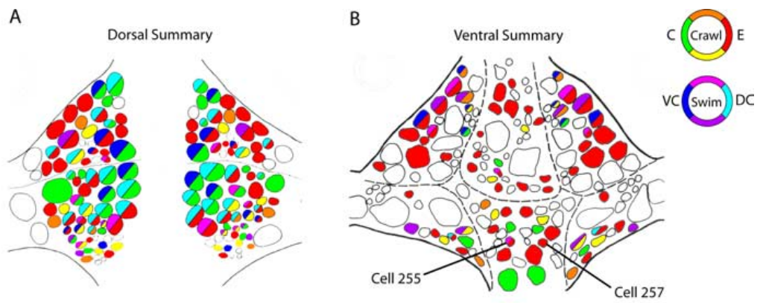
Swimming neurons overlap the crawl population
Briggman and Kristan combined reproducible phase-associated activity across dorsal and ventral imaging experiments. The summary distinguished cells active in both rhythms from cells coherent with only swimming or only crawling. Cells lacking reliable activity were not assigned a behavior merely from anatomical position.
The identified population included about 90 swimming-associated and 188 crawling-associated cells. Of the swimming-associated cells, 84 also oscillated with crawling. Thus most of the observed swim population participated in the slower crawl rhythm, while crawling recruited many additional cells.
Swimming and crawling are therefore generated by a mixture of multifunctional and dedicated circuitry. The phase maps also pointed to unidentified interneurons with distinctive activity, and Briggman and Kristan selected two of them, cells 255 and 257, for intracellular study.
Briggman & Kristan (2006), Fig. 5(A,B). Summary maps of measured shared and selective participation.
Briggman & Kristan (2006)
22
Notes:
Teaching transcript:
Briggman and Kristan combined reproducible phase-associated activity across dorsal and ventral imaging experiments. The summary distinguished cells active in both rhythms from cells coherent with only swimming or only crawling. Cells lacking reliable activity were not assigned a behavior merely from anatomical position.
The identified population included about 90 swimming-associated and 188 crawling-associated cells. Of the swimming-associated cells, 84 also oscillated with crawling. Thus most of the observed swim population participated in the slower crawl rhythm, while crawling recruited many additional cells.
The numerical overlap describes recorded rhythmic participation, not proof that every participating neuron generates the rhythm. Some cells may receive the pattern rather than construct it. Nevertheless, the data reject a simple account in which the two behaviors use entirely separate, nonoverlapping neuronal populations.
The summary maps merge measured participation across preparations. They provide a guide to shared network membership; they are not a complete synaptic wiring diagram and do not determine which connections are causally necessary.
References:
K. L. Briggman; W. B. Kristan Jr (2006). Imaging dedicated and multifunctional neural circuits generating distinct behaviors. Journal of Neuroscience 26(42):10925–10933. https://doi.org/10.1523/JNEUROSCI.3265-06.2006
Briggman & Kristan (2006), Fig. 5(A,B). Summary maps of measured shared and selective participation.
Figure source: https://doi.org/10.1523/JNEUROSCI.3265-06.2006

Slide 29
One small ganglion reuses its neurons across behaviors
A ganglion of about 400 neurons controls swimming, crawling and local bending. Reusing cells in different configurations allows this compact nervous system to produce several behaviors, an economy Ashaber and colleagues attribute to animals with limited neural hardware.
DE-3 marks the extent of reuse. In swimming it oscillates rapidly in antiphase with VE-4, producing dorsal flexion; in crawling it fires together with VE-4 to shorten the segment; in local bending it acts with its contralateral partner and VE-4 to bend the body wall away from a touch. One neuron serves three roles without rewiring.
Dedicated cells add what sharing cannot supply. Crawling recruits about twice as many cells as swimming, including circular-muscle excitors and interneurons such as cell 257 that serve elongation, a phase swimming lacks. Shared cells carry the common longitudinal machinery.
Briggman & Kristan (2006), Fig. 2(A,B). Measured dorsal-surface phase maps for crawling and swimming.
Briggman & Kristan (2006); Ashaber et al. (2021)
22a
Notes:
Slides 20 to 22 count the cells active in each rhythm; what that overlap buys the animal, and what the remaining dedicated cells contribute, follows from the roles of individual motor neurons.
Multifunctionality is an economy.
Ashaber and colleagues observe that many circuits in central nervous systems control more than one behavior, and that this may help small animals use constrained neural hardware efficiently.
In the leech, each segmental ganglion of about 400 cells is responsible for at least three distinct movements.
DE-3 plays three parts.
During swimming DE-3 alternates with the ventral excitor and controls the dorsal flexion phase; during crawling it is active with VE-4 and controls contraction.
During local bending it cooperates with its contralateral homolog and VE-4 to deform the body wall precisely, the reconfiguration slide 23 catches in the switch between cells 3 and 4.
Dedicated cells supply behavior-specific phases.
Briggman and Kristan found more than twice as many crawl participants as swim participants, and CV, AE and cell 257 on slides 21 and 25 belong to the crawl-only group.
These cells serve circular-muscle elongation and annulus erection, actions with no counterpart in a swim stroke.
References:
K. L. Briggman; W. B. Kristan Jr (2006). Imaging dedicated and multifunctional neural circuits generating distinct behaviors. Journal of Neuroscience 26(42):10925–10933. https://doi.org/10.1523/JNEUROSCI.3265-06.2006
M. Ashaber; Y. Tomina; P. Kassraian; E. A. Bushong; W. B. Kristan Jr; M. H. Ellisman; D. A. Wagenaar (2021). Anatomy and activity patterns in a multifunctional motor neuron and its surrounding circuits. eLife 10:e61881. https://doi.org/10.7554/eLife.61881

Slide 30
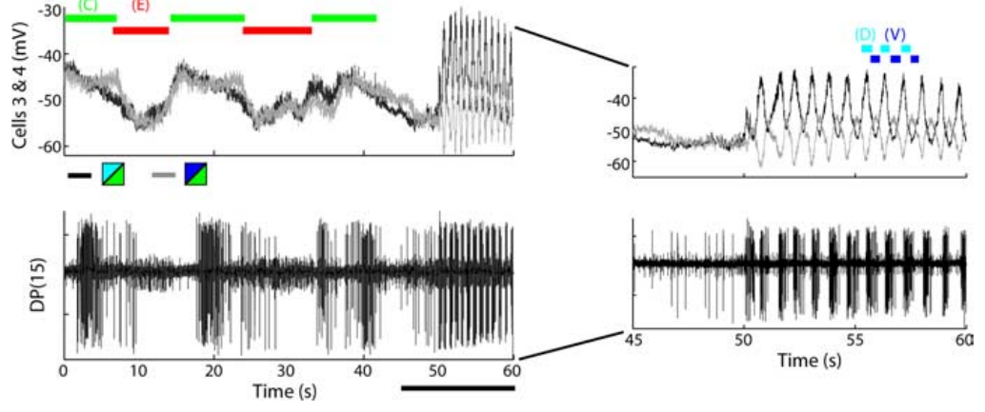
Shared cells change phase at a behavioral switch
Briggman and Kristan observed switches between crawling and swimming while maintaining recordings from identified motor cells. This comparison follows individual neurons across a state change rather than comparing separate animals assigned to different behaviors. Motor-nerve output identified the behavior expressed on either side of the switch.
Cells 3 and 4 were in phase during crawl-related longitudinal contraction but became approximately out of phase during swimming. The transition could occur within 1–2 s. Their relationship therefore changed on a time scale much shorter than any anatomical rebuilding of the neurons.
The shared circuit can express alternative dynamical configurations through changes in active interactions and input. Cells 3 and 4 are the dorsal and ventral longitudinal excitors DE-3 and VE-4, so their change from synchrony to alternation converts whole-body shortening into the up-and-down bending of a swim stroke.
Briggman & Kristan (2006), Fig. 6(E). Motor and intracellular signals at a crawl-to-swim transition.
Briggman & Kristan (2006)
23
Notes:
Teaching transcript:
Briggman and Kristan observed switches between crawling and swimming while maintaining recordings from identified motor cells. This comparison follows individual neurons across a state change rather than comparing separate animals assigned to different behaviors. Motor-nerve output identified the behavior expressed on either side of the switch.
Cells 3 and 4 were in phase during crawl-related longitudinal contraction but became approximately out of phase during swimming. The transition could occur within 1–2 s. Their relationship therefore changed on a time scale much shorter than any anatomical rebuilding of the neurons.
The shared circuit can express alternative dynamical configurations through changes in active interactions and input. The recordings establish rapid reorganization but do not identify its complete molecular trigger. Structural overlap permits flexible use of the same cells; it does not by itself specify the mechanism selecting one motor pattern.
A dynamical configuration describes the timing and relationships of active neurons. The interpretation concerns changes in circuit operation, not a claim that the neuron’s anatomical identity changes when the animal switches locomotor behavior.
References:
K. L. Briggman; W. B. Kristan Jr (2006). Imaging dedicated and multifunctional neural circuits generating distinct behaviors. Journal of Neuroscience 26(42):10925–10933. https://doi.org/10.1523/JNEUROSCI.3265-06.2006
Briggman & Kristan (2006), Fig. 6(E). Motor and intracellular signals at a crawl-to-swim transition.
Figure source: https://doi.org/10.1523/JNEUROSCI.3265-06.2006

Slide 31
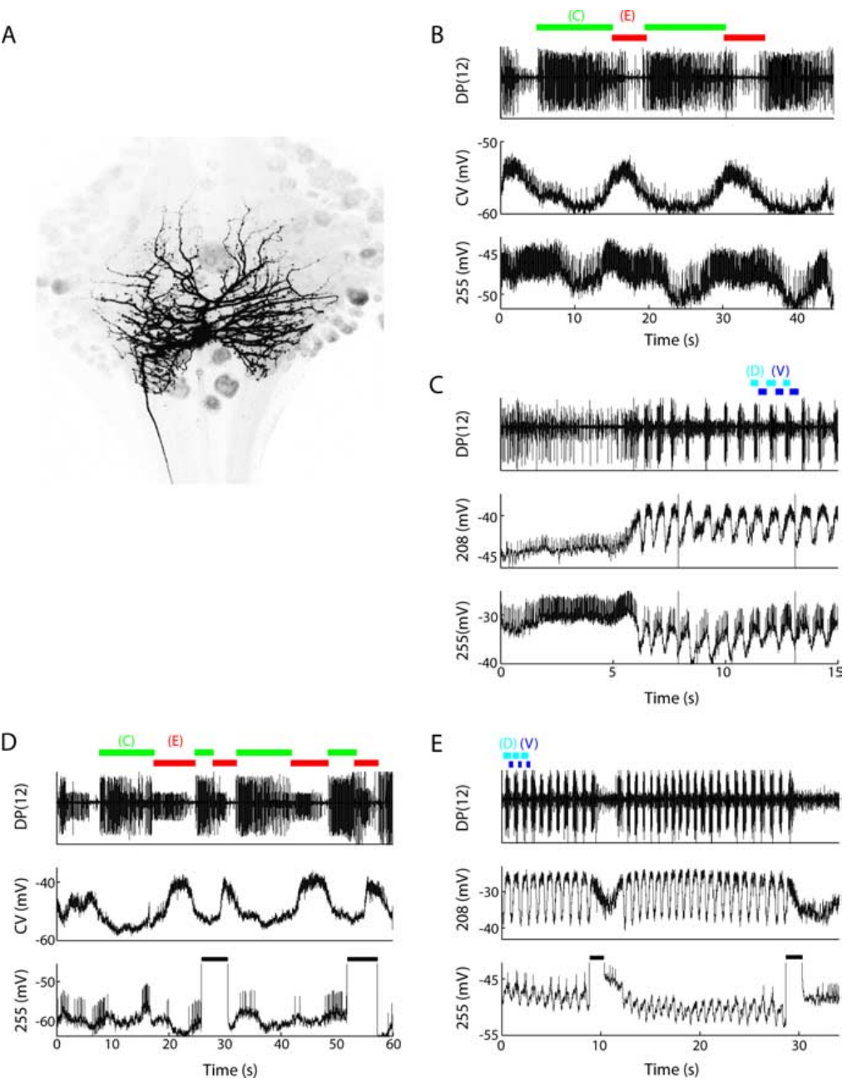
Cell 255 can perturb both locomotor rhythms
Briggman and Kristan identified cell 255 by its ventral soma position, morphology, and activity. An interneuron communicates within the nervous system rather than directly innervating a peripheral muscle. Cell 255 had bilateral arbors and projected through a central connective, supporting its interneuronal identity.
Cell 255 depolarized during crawl elongation and oscillated during swimming. Depolarizing it during crawl contraction ended that phase early and shortened the step period by approximately 21%. Depolarization during elongation did not change the period; stimulation during swimming could slow or terminate the episode.
Current injection supplies causal evidence beyond correlation with a rhythm. The phase specificity argues that the effect depends on the current circuit state. Briggman and Kristan therefore classified cell 255 as a multifunctional interneuron that oscillates with, and can perturb, both rhythms.
Briggman & Kristan (2006), Fig. 7(A–E). Identified cell 255 morphology and recordings with perturbations.
Briggman & Kristan (2006)
24
Notes:
Teaching transcript:
Briggman and Kristan identified cell 255 by its ventral soma position, morphology, and activity. An interneuron communicates within the nervous system rather than directly innervating a peripheral muscle. Cell 255 had bilateral arbors and projected through a central connective, supporting its interneuronal identity.
Cell 255 depolarized during crawl elongation and oscillated during swimming. Depolarizing it during crawl contraction ended that phase early and shortened the step period by approximately 21%. Depolarization during elongation did not change the period; stimulation during swimming could slow or terminate the episode.
Current injection supplies causal evidence beyond correlation with a rhythm. The phase specificity argues that the effect depends on the current circuit state. The absence of a consistent effect from hyperpolarizing the cell prevents treating this experiment as proof that cell 255 alone is necessary for either rhythm.
The original figure includes the filled cell and recordings during both behaviors. A cell can influence two patterns in different ways: accelerating a transition in one and reducing or terminating activity in the other.
References:
K. L. Briggman; W. B. Kristan Jr (2006). Imaging dedicated and multifunctional neural circuits generating distinct behaviors. Journal of Neuroscience 26(42):10925–10933. https://doi.org/10.1523/JNEUROSCI.3265-06.2006
Briggman & Kristan (2006), Fig. 7(A–E). Identified cell 255 morphology and recordings with perturbations.
Figure source: https://doi.org/10.1523/JNEUROSCI.3265-06.2006

Slide 32
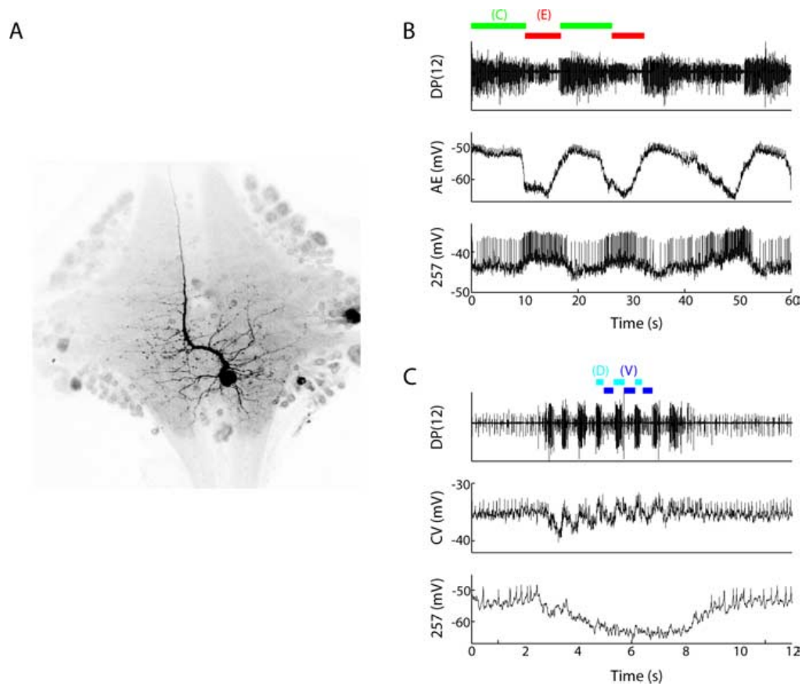
Cell 257 is crawl-associated without a proven command role
Briggman and Kristan identified cell 257 as a ventral interneuron with a projection through an anterior connective. Its morphology differed from cell 255, and its activity was recorded together with the annulus erector cell. The comparison used crawling and swimming in the same preparation.
During crawling, cell 257 depolarized and fired with the elongation phase. During swimming it became strongly hyperpolarized and did not express a coherent swim rhythm. The published recordings preserve a 20 mV calibration and a 2 s time bar for the swimming comparison.
This pattern supports selectively crawl-associated participation. Strong hyperpolarization during swimming means the active swim network suppresses cell 257, so this crawl-dedicated interneuron is held silent rather than merely left unexcited while the leech swims.
Briggman & Kristan (2006), Fig. 8(A–C). Cell 257 anatomy and crawl-versus-swim intracellular recordings.
Briggman & Kristan (2006)
25
Notes:
Teaching transcript:
Briggman and Kristan identified cell 257 as a ventral interneuron with a projection through an anterior connective. Its morphology differed from cell 255, and its activity was recorded together with the annulus erector cell. The comparison used crawling and swimming in the same preparation.
During crawling, cell 257 depolarized and fired with the elongation phase. During swimming it became strongly hyperpolarized and did not express a coherent swim rhythm. The published recordings preserve a 20 mV calibration and a 2 s time bar for the swimming comparison.
This pattern supports selectively crawl-associated participation. Depolarizing or hyperpolarizing a single cell 257 did not consistently perturb either rhythm, so participation does not establish an initiating or indispensable role. The distinction between observing a cell’s phase and causally controlling the pattern is essential to interpreting population maps.
Hyperpolarization moves membrane voltage toward a more negative value and can reduce spiking. The recording establishes behavior-dependent suppression of cell 257, while leaving the full source of that inhibition unresolved.
References:
K. L. Briggman; W. B. Kristan Jr (2006). Imaging dedicated and multifunctional neural circuits generating distinct behaviors. Journal of Neuroscience 26(42):10925–10933. https://doi.org/10.1523/JNEUROSCI.3265-06.2006
Briggman & Kristan (2006), Fig. 8(A–C). Cell 257 anatomy and crawl-versus-swim intracellular recordings.
Figure source: https://doi.org/10.1523/JNEUROSCI.3265-06.2006

Slide 33
Correlation, sufficiency and necessity are separate tests
Correlation means its activity rises and falls with the rhythm. Sufficiency means activating it alone can start or alter the behavior. Necessity means silencing it stops or changes the behavior. A command neuron, in the strict sense, passes both of the last two tests.
Cell 257 is correlated with crawling, yet neither depolarizing nor hyperpolarizing it changed either rhythm. Cell 255 is correlated with both rhythms and can perturb both. Cell 1 can lengthen the period of an isolated swim rhythm. R3b-1 is both sufficient and necessary for coordinated fictive crawling.
A failed necessity test often reflects distribution rather than irrelevance. Rhythms here arise from many interacting cells, so silencing one leaves others to carry the pattern. R3b-1 passes the test by occupying a bottleneck: one paired descending neuron carries a coordinating signal to every segment.
Briggman & Kristan (2006), Fig. 7(A–E). Identified cell 255 morphology and recordings with perturbations.
Briggman & Kristan (2006); Puhl et al. (2012)
25a
Notes:
Slides 24 and 25 report opposite outcomes for two interneurons; sorting the deck's single-cell experiments by the kind of evidence they provide makes the difference interpretable.
Each test answers a different question.
Recording activity during a rhythm asks whether a cell takes part; injecting depolarizing current asks whether it can drive the behavior; injecting hyperpolarizing current asks whether the behavior survives without it.
Puhl and colleagues describe R3b-1 as a command neuron in the strictest sense because it passed both causal tests.
The deck's cells span the scale.
Briggman and Kristan classify cell 255 as multifunctional because it oscillates with and can perturb both rhythms, and cell 257 as dedicated to crawling.
Kristan and Calabrese's cell 1 on slide 12 is evidence that even a motor neuron can act back on an isolated oscillator.
Distributed circuits blunt single-cell silencing.
Imaging on slide 22 placed scores of cells in each rhythm, so removing one rarely removes a unique function.
A descending neuron whose single axon projects through every ganglion is different, since its signal has no parallel carrier once its partner is excluded.
References:
K. L. Briggman; W. B. Kristan Jr (2006). Imaging dedicated and multifunctional neural circuits generating distinct behaviors. Journal of Neuroscience 26(42):10925–10933. https://doi.org/10.1523/JNEUROSCI.3265-06.2006
J. G. Puhl; M. A. Masino; K. A. Mesce (2012). Necessary, sufficient and permissive: a single locomotor command neuron important for intersegmental coordination. Journal of Neuroscience 32(49):17646–17657. https://doi.org/10.1523/JNEUROSCI.2249-12.2012
W. B. Kristan Jr; R. L. Calabrese (1976). Rhythmic swimming activity in neurones of the isolated nerve cord of the leech. Journal of Experimental Biology 65(3):643–668. https://doi.org/10.1242/jeb.65.3.643

Slide 34
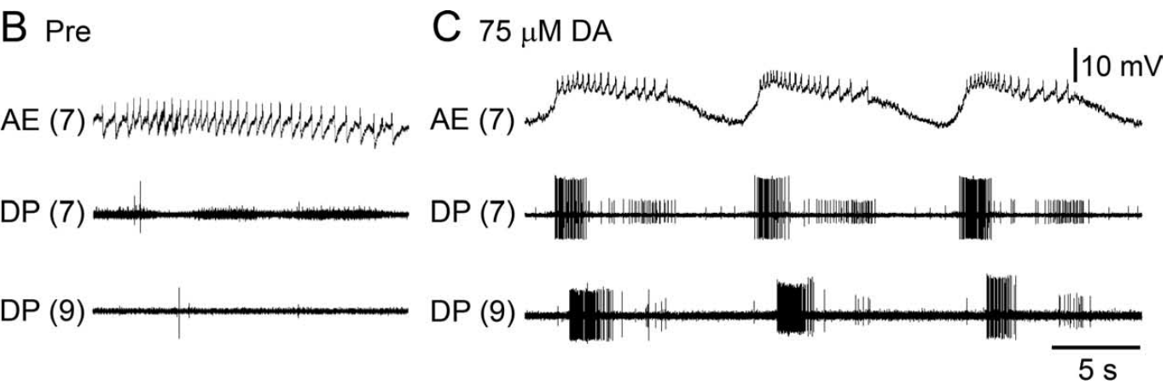
Dopamine recruits crawl-like activity in an isolated CNS
Dopamine is a neurotransmitter that can alter the functional state of locomotor circuits. Puhl and Mesce superfused isolated whole leech nervous systems with dopamine while monitoring motor nerves and an identified motor neuron. The preparation retained the cephalic and segmental ganglia but lacked the peripheral body.
At approximately 75 μM dopamine, previously quiet motor nerves developed repeated DE-3 bursts. Crawl-like activity could emerge after about 3 min and later acquire anterior-to-posterior propagation. Some preparations became coordinated during dopamine exposure, while others did so during washout.
Puhl & Mesce (2008), Fig. 1(B,C). Motor activity before and during dopamine exposure.
Dopamine is sufficient to make a crawl-like motor program available in this preparation. Puhl and Mesce found that every isolated ganglion of the CNS was competent to produce dopamine-induced crawling, typically uninterrupted for 5–15 min, so crawl generators are distributed along the entire cord.
Ashaber et al. (2021), Fig. 7(a). Reconstructed DE-3 arbor over a dorsal micro-CT image.
Puhl & Mesce (2008); Ashaber et al. (2021)
26
Notes:
Teaching transcript:
Dopamine is a neurotransmitter that can alter the functional state of locomotor circuits. Puhl and Mesce superfused isolated whole leech nervous systems with dopamine while monitoring motor nerves and an identified motor neuron. The preparation retained the cephalic and segmental ganglia but lacked the peripheral body.
At approximately 75 μM dopamine, previously quiet motor nerves developed repeated DE-3 bursts. Crawl-like activity could emerge after about 3 min and later acquire anterior-to-posterior propagation. Some preparations became coordinated during dopamine exposure, while others did so during washout.
Dopamine is sufficient to make a crawl-like motor program available in this preparation. The result is not a measurement of natural dopamine concentration at each receptor or proof that dopamine alone determines intact behavioral choice. Local pattern activation and intersegmental coordination remain distinguishable outcomes.
The supplied concentration is a bath concentration chosen for the experimental preparation. It should not be equated with a measured concentration at an endogenous release site.
References:
J. G. Puhl; K. A. Mesce (2008). Dopamine activates the motor pattern for crawling in the medicinal leech. Journal of Neuroscience 28(16):4192–4200. https://doi.org/10.1523/JNEUROSCI.0136-08.2008
M. Ashaber; Y. Tomina; P. Kassraian; E. A. Bushong; W. B. Kristan Jr; M. H. Ellisman; D. A. Wagenaar (2021). Anatomy and activity patterns in a multifunctional motor neuron and its surrounding circuits. eLife 10:e61881. https://doi.org/10.7554/eLife.61881
Puhl & Mesce (2008), Fig. 1(B,C). Motor activity before and during dopamine exposure.
Figure source: https://doi.org/10.1523/JNEUROSCI.0136-08.2008
Ashaber et al. (2021), Fig. 7(a). Reconstructed DE-3 arbor over a dorsal micro-CT image.
Figure source: https://doi.org/10.7554/eLife.61881

Slide 35
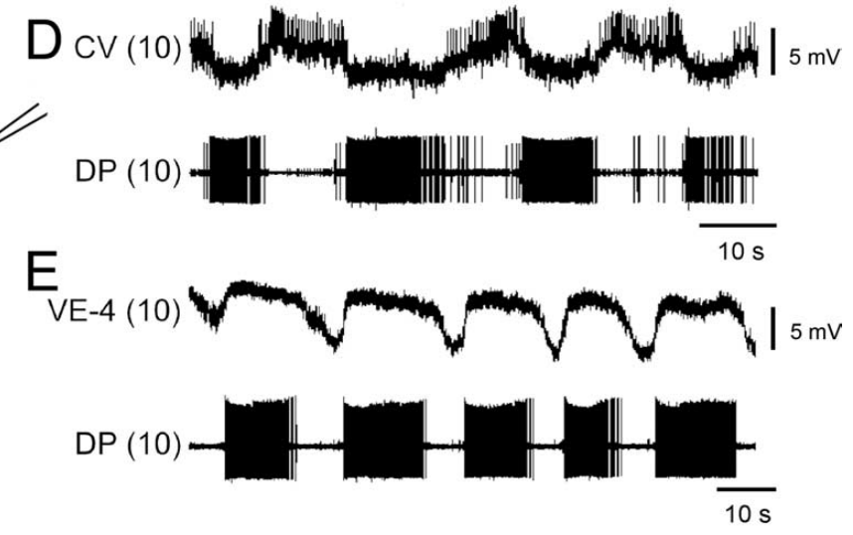
Crawling alternates circular and longitudinal excitation
Puhl and Mesce recorded intracellularly from the circular excitor CV and the ventral longitudinal excitor VE-4 during dopamine-induced fictive crawling. Simultaneous dorsal posterior nerve recordings monitored DE-3, the dorsal longitudinal excitor. This pairing identified the motor pattern through several muscle-related outputs.
CV activity was approximately 180° out of phase with DE-3. During the DE-3 burst, CV hyperpolarized by approximately 2–4 mV and its spikes were suppressed. VE-4 instead depolarized and fired in phase with DE-3, consistent with coordinated dorsal and ventral shortening.
Correct muscle-group phasing is stronger evidence for a crawl program than a slow DE-3 burst alone. CV firing while the longitudinal excitors are silent makes circular muscles squeeze and lengthen the segment, and the following longitudinal burst shortens it, giving one elongation and one contraction per cycle.
Puhl & Mesce (2008), Fig. 2(D,E). CV and VE-4 activity relative to the DE-3 motor burst.
Ashaber et al. (2021), Fig. 7(a). Reconstructed DE-3 arbor over a dorsal micro-CT image.
Puhl & Mesce (2008); Ashaber et al. (2021)
27
Notes:
Teaching transcript:
Puhl and Mesce recorded intracellularly from the circular excitor CV and the ventral longitudinal excitor VE-4 during dopamine-induced fictive crawling. Simultaneous dorsal posterior nerve recordings monitored DE-3, the dorsal longitudinal excitor. This pairing identified the motor pattern through several muscle-related outputs.
CV activity was approximately 180° out of phase with DE-3. During the DE-3 burst, CV hyperpolarized by approximately 2–4 mV and its spikes were suppressed. VE-4 instead depolarized and fired in phase with DE-3, consistent with coordinated dorsal and ventral shortening.
Correct muscle-group phasing is stronger evidence for a crawl program than a slow DE-3 burst alone. The recordings establish patterned excitation and suppression in the motor outputs. They do not identify every interneuron that imposes the phase relationships or directly measure the resulting muscle force.
Antagonist muscle actions have opposing mechanical effects. Here circular-muscle activity favors elongation while longitudinal-muscle activity favors shortening; their alternating recruitment is part of the definition of the crawl pattern.
References:
J. G. Puhl; K. A. Mesce (2008). Dopamine activates the motor pattern for crawling in the medicinal leech. Journal of Neuroscience 28(16):4192–4200. https://doi.org/10.1523/JNEUROSCI.0136-08.2008
M. Ashaber; Y. Tomina; P. Kassraian; E. A. Bushong; W. B. Kristan Jr; M. H. Ellisman; D. A. Wagenaar (2021). Anatomy and activity patterns in a multifunctional motor neuron and its surrounding circuits. eLife 10:e61881. https://doi.org/10.7554/eLife.61881
Puhl & Mesce (2008), Fig. 2(D,E). CV and VE-4 activity relative to the DE-3 motor burst.
Figure source: https://doi.org/10.1523/JNEUROSCI.0136-08.2008
Ashaber et al. (2021), Fig. 7(a). Reconstructed DE-3 arbor over a dorsal micro-CT image.
Figure source: https://doi.org/10.7554/eLife.61881

Slide 36
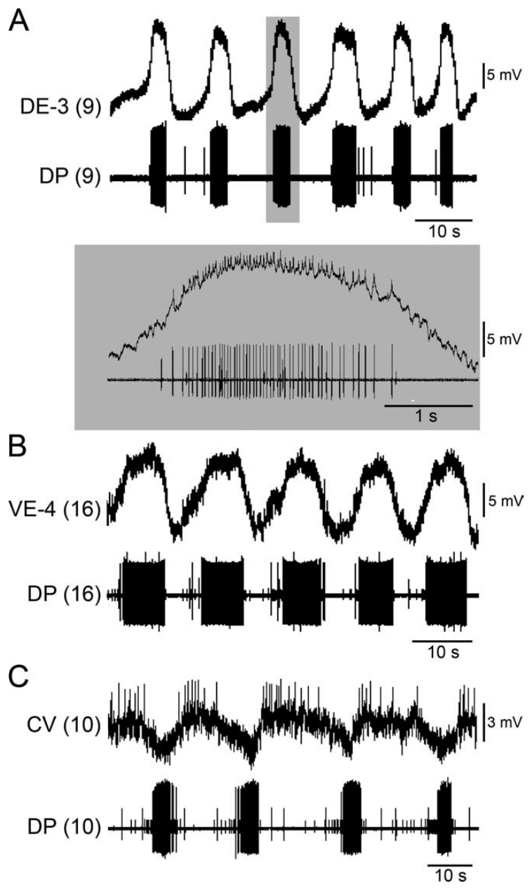
A single ganglion can express the local crawl pattern
Puhl and Mesce separated individual segmental ganglia from the rest of the nerve cord and applied dopamine. This reduction removed descending input and intersegmental communication. Intracellular recordings identified DE-3, VE-4, and CV while a motor-nerve recording monitored the local output.
Dopamine induced repeated, appropriately phased activity in all three motor-cell classes. DE-3 depolarizations reached approximately 12–16 mV, with smaller spikes riding on the slow voltage wave. Intracellular DE-3 spikes matched the largest extracellular motor unit one for one, validating the nerve-based monitor.
Ashaber et al. (2021), Fig. 7(a). Reconstructed DE-3 arbor over a dorsal micro-CT image.
A segmental ganglion contains circuitry sufficient for local crawl-like pattern production under these conditions. Single ganglia and whole cords bursting with similar periods near 15 s indicates that each cycle is timed within the ganglion rather than by signals from other segments.
Puhl & Mesce (2008), Fig. 3(A–C). Identified excitatory motor-cell activity in isolated ganglia.
Puhl & Mesce (2008); Ashaber et al. (2021)
28
Notes:
Teaching transcript:
Puhl and Mesce separated individual segmental ganglia from the rest of the nerve cord and applied dopamine. This reduction removed descending input and intersegmental communication. Intracellular recordings identified DE-3, VE-4, and CV while a motor-nerve recording monitored the local output.
Dopamine induced repeated, appropriately phased activity in all three motor-cell classes. DE-3 depolarizations reached approximately 12–16 mV, with smaller spikes riding on the slow voltage wave. Intracellular DE-3 spikes matched the largest extracellular motor unit one for one, validating the nerve-based monitor.
A segmental ganglion contains circuitry sufficient for local crawl-like pattern production under these conditions. A single ganglion cannot establish a full front-to-back behavioral sequence by itself. Local rhythm-generating capacity therefore does not settle how the intact cord coordinates segments or chooses the next movement.
A slow wave is a membrane-potential fluctuation on which faster action potentials can ride. The agreement between intracellular spikes and the nerve unit checks cell identity, while the slow wave reflects the patterned drive reaching that motor neuron.
References:
J. G. Puhl; K. A. Mesce (2008). Dopamine activates the motor pattern for crawling in the medicinal leech. Journal of Neuroscience 28(16):4192–4200. https://doi.org/10.1523/JNEUROSCI.0136-08.2008
M. Ashaber; Y. Tomina; P. Kassraian; E. A. Bushong; W. B. Kristan Jr; M. H. Ellisman; D. A. Wagenaar (2021). Anatomy and activity patterns in a multifunctional motor neuron and its surrounding circuits. eLife 10:e61881. https://doi.org/10.7554/eLife.61881
Puhl & Mesce (2008), Fig. 3(A–C). Identified excitatory motor-cell activity in isolated ganglia.
Figure source: https://doi.org/10.1523/JNEUROSCI.0136-08.2008
Ashaber et al. (2021), Fig. 7(a). Reconstructed DE-3 arbor over a dorsal micro-CT image.
Figure source: https://doi.org/10.7554/eLife.61881

Slide 37
A half-center model explains alternation within one ganglion
Locomotion in segmented animals is thought to arise from coupled unit burst generators, rhythmic modules that each drive one segment. In the leech crawl, that module is the single ganglion.
A common proposal for how a module alternates is the half-center oscillator: two groups of neurons, one exciting elongation motor neurons such as CV and the other exciting contraction motor neurons such as DE-3 and VE-4, inhibit each other. While one group fires it holds the other silent; as its drive fades, the suppressed group escapes and takes over, producing antiphase bursts.
Premotor nonspiking (NS) neurons link motor neurons to this generator, and strongly hyperpolarizing one NS neuron stops an isolated ganglion's rhythm. The generator also inhibits touch cells in phase with each DE-3 burst, a corollary discharge telling sensory neurons that contraction is under way.
Puhl & Mesce (2008), Fig. 3(A–C). Identified excitatory motor-cell activity in isolated ganglia.
Puhl & Mesce (2008); Kearney et al. (2022)
28a
Notes:
Slide 28 places a complete crawl generator in each ganglion; the concepts used to describe such generators explain how one ganglion could alternate two antagonistic phases.
Segmented locomotion is built from modules.
Puhl and Mesce frame their work around the idea of unit burst generators coupled along the body, a scheme whose biological basis had been revealed in only a few animals.
Their finding that every isolated ganglion could produce dopamine-induced crawling identifies the leech module.
Mutual inhibition produces alternation.
Kearney and colleagues summarize earlier proposals that crawling is controlled by a half-center oscillator, two neuron groups driving the elongation and contraction motor neurons.
The antiphase of CV with DE-3 and VE-4 on slide 27, and of the inhibitors with DE-3 on slide 29, is the output such an oscillator should produce.
Other cells tap into the generator.
Hyperpolarizing an NS neuron with a strong pulse abolished both the DE-3 bursts and the rhythmic inhibition of touch cells, evidence that NS reaches the generator itself rather than only the motor neurons.
An internal copy of the motor command sent to sensory neurons allows the ganglion to distinguish its own movement from external touch.
References:
J. G. Puhl; K. A. Mesce (2008). Dopamine activates the motor pattern for crawling in the medicinal leech. Journal of Neuroscience 28(16):4192–4200. https://doi.org/10.1523/JNEUROSCI.0136-08.2008
G. Kearney; M. Radice; A. Sanchez Merlinsky; L. Szczupak (2022). Intersegmental interactions give rise to a global network. Frontiers in Neural Circuits 16:843731. https://doi.org/10.3389/fncir.2022.843731

Slide 38
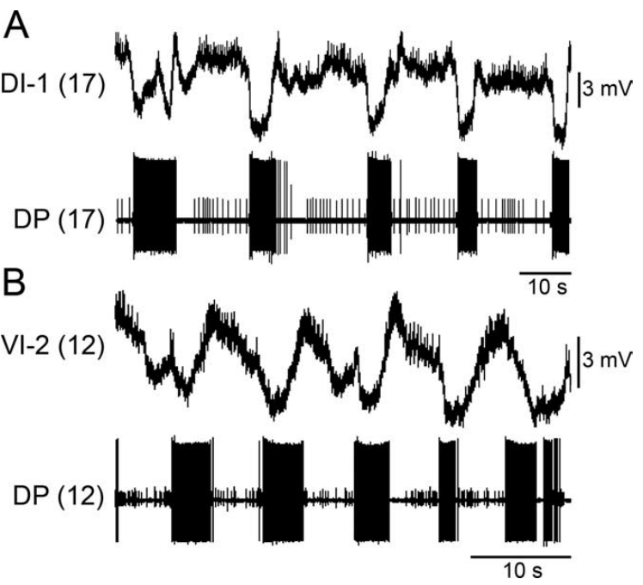
Inhibitory motor cells alternate with contraction outputs
Puhl and Mesce recorded the dorsal inhibitor DI-1 and ventral inhibitor VI-2 in isolated ganglia during dopamine-induced crawling. Both are motor neurons associated with inhibition of longitudinal muscle pathways. Simultaneous DE-3 recording identified the contraction-related output of the same local circuit.
Their activity was largely opposite to DE-3 bursting. DI-1 was suppressed during the contraction phase and became more active toward its termination. VI-2 could produce inhibitory potentials in VE-4, directly connecting an inhibitory motor pathway with reduced activity in a longitudinal excitor.
Ashaber et al. (2021), Fig. 7(a). Reconstructed DE-3 arbor over a dorsal micro-CT image.
An inhibitory postsynaptic potential is a synaptic voltage change that reduces the likelihood of firing in the receiving neuron. Inhibitory motor neurons act at two levels: at the muscle they relax longitudinal fibers, and within the ganglion VI-2 suppresses VE-4, so contraction is curtailed both peripherally and centrally.
Puhl & Mesce (2008), Fig. 4(A,B). DI-1 and VI-2 activity relative to DE-3 during fictive crawling.
Puhl & Mesce (2008); Ashaber et al. (2021)
29
Notes:
Teaching transcript:
Puhl and Mesce recorded the dorsal inhibitor DI-1 and ventral inhibitor VI-2 in isolated ganglia during dopamine-induced crawling. Both are motor neurons associated with inhibition of longitudinal muscle pathways. Simultaneous DE-3 recording identified the contraction-related output of the same local circuit.
Their activity was largely opposite to DE-3 bursting. DI-1 was suppressed during the contraction phase and became more active toward its termination. VI-2 could produce inhibitory potentials in VE-4, directly connecting an inhibitory motor pathway with reduced activity in a longitudinal excitor.
An inhibitory postsynaptic potential is a synaptic voltage change that reduces the likelihood of firing in the receiving neuron. These recordings support coordinated inhibitory and excitatory contributions to alternating movement phases. The experiment does not assign a transmitter or receptor subtype solely from the direction of the voltage change.
Postsynaptic refers to the receiving side of a synapse. Recording a voltage change in VE-4 while identifying VI-2 activity links cell timing to inhibition, but molecular identification requires evidence beyond a membrane-potential trace.
References:
J. G. Puhl; K. A. Mesce (2008). Dopamine activates the motor pattern for crawling in the medicinal leech. Journal of Neuroscience 28(16):4192–4200. https://doi.org/10.1523/JNEUROSCI.0136-08.2008
M. Ashaber; Y. Tomina; P. Kassraian; E. A. Bushong; W. B. Kristan Jr; M. H. Ellisman; D. A. Wagenaar (2021). Anatomy and activity patterns in a multifunctional motor neuron and its surrounding circuits. eLife 10:e61881. https://doi.org/10.7554/eLife.61881
Puhl & Mesce (2008), Fig. 4(A,B). DI-1 and VI-2 activity relative to DE-3 during fictive crawling.
Figure source: https://doi.org/10.1523/JNEUROSCI.0136-08.2008
Ashaber et al. (2021), Fig. 7(a). Reconstructed DE-3 arbor over a dorsal micro-CT image.
Figure source: https://doi.org/10.7554/eLife.61881

Slide 39
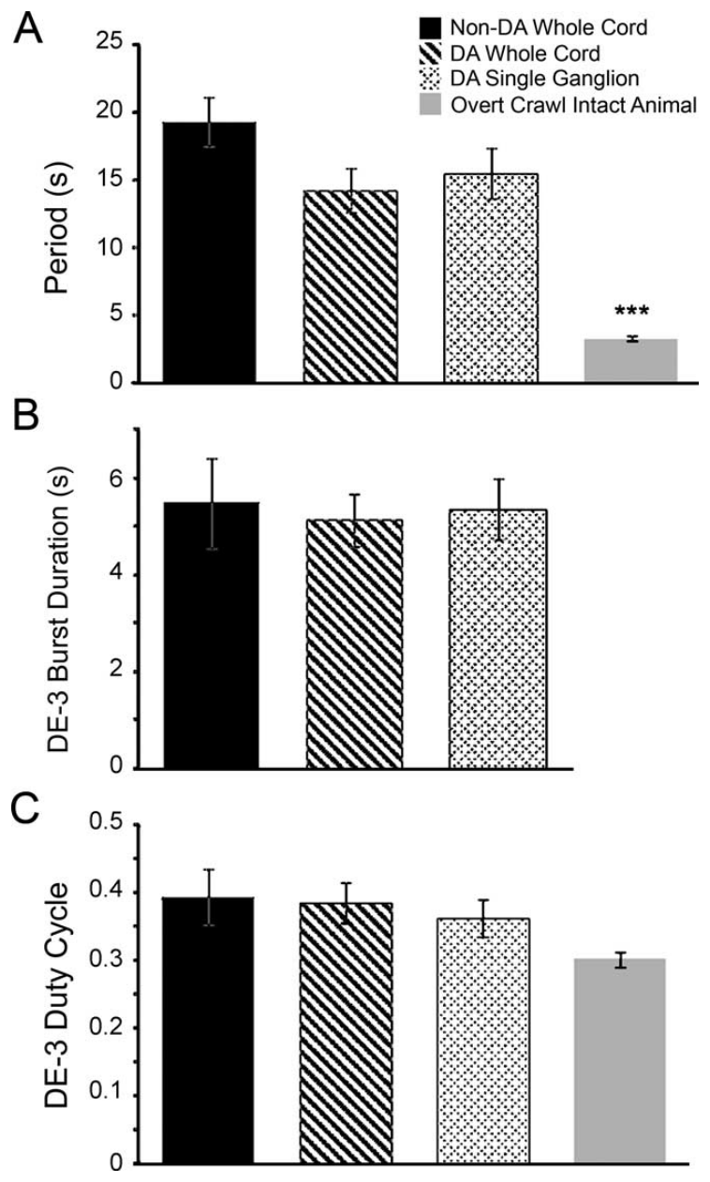
Fictive crawl rhythms resemble spontaneous crawling
Puhl and Mesce compared dopamine-induced rhythms in whole cords and single ganglia with spontaneous or electrically induced fictive crawling. They also measured overt crawling from video. The comparisons used cycle period and the duration of contraction-related DE-3 bursts to test similarity of motor organization.
Fictive crawling had periods on the order of 10–15 s in these preparations, whereas overt crawling averaged approximately 3.3 s. The fraction of a fictive cycle occupied by DE-3 bursting was broadly similar across the neural preparations despite their differences in size and induction method.
Ashaber et al. (2021), Fig. 7(a). Reconstructed DE-3 arbor over a dorsal micro-CT image.
A duty cycle is the fraction of a repeating cycle occupied by a defined active phase. Similar duty cycles across whole cords, single ganglia and spontaneous fictive crawling indicate that dopamine engages the motor program the nervous system uses on its own, rather than an artificial drug rhythm.
Puhl & Mesce (2008), Fig. 7. Original quantitative comparisons of crawl period and duty cycle.
Puhl & Mesce (2008); Ashaber et al. (2021)
30
Notes:
Teaching transcript:
Puhl and Mesce compared dopamine-induced rhythms in whole cords and single ganglia with spontaneous or electrically induced fictive crawling. They also measured overt crawling from video. The comparisons used cycle period and the duration of contraction-related DE-3 bursts to test similarity of motor organization.
Fictive crawling had periods on the order of 10–15 s in these preparations, whereas overt crawling averaged approximately 3.3 s. The fraction of a fictive cycle occupied by DE-3 bursting was broadly similar across the neural preparations despite their differences in size and induction method.
A duty cycle is the fraction of a repeating cycle occupied by a defined active phase. Comparable duty cycles support a shared pattern, but slower fictive periods limit equivalence with intact movement. The reduced preparation exposes central activity without recreating every sensory, mechanical, or motivational condition of natural crawling.
The overt contraction measurement used sucker release and attachment, while the fictive contraction proxy used DE-3 activity. Those measurements are related but not identical, so the result supports a motor-pattern comparison rather than complete behavioral identity.
References:
J. G. Puhl; K. A. Mesce (2008). Dopamine activates the motor pattern for crawling in the medicinal leech. Journal of Neuroscience 28(16):4192–4200. https://doi.org/10.1523/JNEUROSCI.0136-08.2008
M. Ashaber; Y. Tomina; P. Kassraian; E. A. Bushong; W. B. Kristan Jr; M. H. Ellisman; D. A. Wagenaar (2021). Anatomy and activity patterns in a multifunctional motor neuron and its surrounding circuits. eLife 10:e61881. https://doi.org/10.7554/eLife.61881
Puhl & Mesce (2008), Fig. 7. Original quantitative comparisons of crawl period and duty cycle.
Figure source: https://doi.org/10.1523/JNEUROSCI.0136-08.2008
Ashaber et al. (2021), Fig. 7(a). Reconstructed DE-3 arbor over a dorsal micro-CT image.
Figure source: https://doi.org/10.7554/eLife.61881

Slide 40
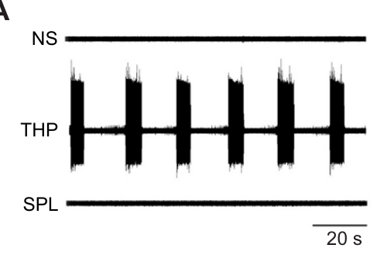
Phosphodiesterase inhibition can recruit slow bursting
Crisp and colleagues tested whether cyclic AMP signaling could contribute to dopamine-associated crawling. Cyclic AMP, or cAMP, is an intracellular signaling molecule. A phosphodiesterase is an enzyme that breaks down cyclic nucleotides; inhibiting it can prolong their intracellular availability.
Bath application of 4.4 mM theophylline caused DE-3 bursting after approximately 10–20 min in isolated ganglia. A polar theophylline-related compound that blocked extracellular adenosine receptors without reproducing intracellular phosphodiesterase inhibition did not induce the same rhythm. Normal-saline recordings supplied the untreated comparison.
Crisp et al. (2012), Fig. 1(A). Theophylline, saline and extracellular-action control recordings.
The control supports an intracellular contribution rather than attributing bursting simply to adenosine receptor blockade. Inhibiting phosphodiesterase raises cAMP, a messenger often produced when dopamine binds DA1-like receptors, which links this drug test to the way dopamine itself may start crawling.
Ashaber et al. (2021), Fig. 7(a). Reconstructed DE-3 arbor over a dorsal micro-CT image.
Crisp et al. (2012); Ashaber et al. (2021)
31
Notes:
Teaching transcript:
Crisp and colleagues tested whether cyclic AMP signaling could contribute to dopamine-associated crawling. Cyclic AMP, or cAMP, is an intracellular signaling molecule. A phosphodiesterase is an enzyme that breaks down cyclic nucleotides; inhibiting it can prolong their intracellular availability.
Bath application of 4.4 mM theophylline caused DE-3 bursting after approximately 10–20 min in isolated ganglia. A polar theophylline-related compound that blocked extracellular adenosine receptors without reproducing intracellular phosphodiesterase inhibition did not induce the same rhythm. Normal-saline recordings supplied the untreated comparison.
The control supports an intracellular contribution rather than attributing bursting simply to adenosine receptor blockade. It does not prove that theophylline acts exclusively through one enzyme or that dopamine uses an identical pathway. The measured endpoint is slow motor bursting, whose complete phase organization must be tested separately.
A polar drug may cross membranes less readily than a related nonpolar compound. The control used this distinction to separate extracellular receptor effects from the intracellular effects being investigated.
References:
K. M. Crisp; B. R. Gallagher; K. A. Mesce (2012). Mechanisms contributing to the dopamine induction of crawl-like bursting in leech motoneurons. Journal of Experimental Biology 215(17):3028–3036. https://doi.org/10.1242/jeb.069245
M. Ashaber; Y. Tomina; P. Kassraian; E. A. Bushong; W. B. Kristan Jr; M. H. Ellisman; D. A. Wagenaar (2021). Anatomy and activity patterns in a multifunctional motor neuron and its surrounding circuits. eLife 10:e61881. https://doi.org/10.7554/eLife.61881
Crisp et al. (2012), Fig. 1(A). Theophylline, saline and extracellular-action control recordings.
Figure source: https://doi.org/10.1242/jeb.069245
Ashaber et al. (2021), Fig. 7(a). Reconstructed DE-3 arbor over a dorsal micro-CT image.
Figure source: https://doi.org/10.7554/eLife.61881

Slide 41
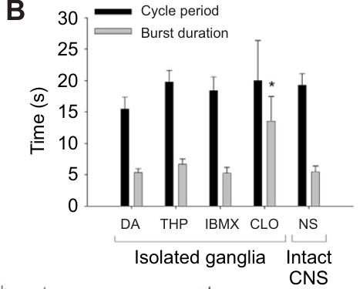
Elevating cyclic AMP does not identify a dopamine receptor
Crisp and colleagues applied the phosphodiesterase inhibitor IBMX to leech neural tissue and measured cAMP using an enzyme immunoassay. An immunoassay uses molecular binding to quantify a target substance. This measurement checked whether the proposed intracellular signal actually increased after treatment.
After 30 min in 0.5 mM IBMX, extract cAMP increased from approximately 12.9 to 29.4 pmol per ml. IBMX and dopamine could each support DE-3 bursts with periods near 20 s, and their coapplication did not abolish rhythmic bursting.
Ashaber et al. (2021), Fig. 7(a). Reconstructed DE-3 arbor over a dorsal micro-CT image.
The biochemical and physiological results are consistent with a cAMP-associated route to rhythmicity. Crisp and colleagues proposed that phosphodiesterase inhibitors and dopamine both activate a sodium-dependent timing mechanism that sets the crawl rhythm, while several dopamine receptor subtypes shape individual motor neurons.
Crisp et al. (2012), Fig. 1(B). Measured burst periods and durations across experimental conditions.
Crisp et al. (2012); Ashaber et al. (2021)
32
Notes:
Teaching transcript:
Crisp and colleagues applied the phosphodiesterase inhibitor IBMX to leech neural tissue and measured cAMP using an enzyme immunoassay. An immunoassay uses molecular binding to quantify a target substance. This measurement checked whether the proposed intracellular signal actually increased after treatment.
After 30 min in 0.5 mM IBMX, extract cAMP increased from approximately 12.9 to 29.4 pmol per ml. IBMX and dopamine could each support DE-3 bursts with periods near 20 s, and their coapplication did not abolish rhythmic bursting.
The biochemical and physiological results are consistent with a cAMP-associated route to rhythmicity. They do not directly identify a DA1-like receptor or prove that dopamine and IBMX converge on one molecular pathway. That receptor-based explanation remains a proposal requiring receptor-specific evidence in the relevant circuit cells.
DA1-like signaling often involves increases in cAMP, but similarity of downstream effects is not a receptor-identification assay. The original paper explicitly separates possible common pathways from mechanisms that could operate in parallel.
References:
K. M. Crisp; B. R. Gallagher; K. A. Mesce (2012). Mechanisms contributing to the dopamine induction of crawl-like bursting in leech motoneurons. Journal of Experimental Biology 215(17):3028–3036. https://doi.org/10.1242/jeb.069245
M. Ashaber; Y. Tomina; P. Kassraian; E. A. Bushong; W. B. Kristan Jr; M. H. Ellisman; D. A. Wagenaar (2021). Anatomy and activity patterns in a multifunctional motor neuron and its surrounding circuits. eLife 10:e61881. https://doi.org/10.7554/eLife.61881
Crisp et al. (2012), Fig. 1(B). Measured burst periods and durations across experimental conditions.
Figure source: https://doi.org/10.1242/jeb.069245
Ashaber et al. (2021), Fig. 7(a). Reconstructed DE-3 arbor over a dorsal micro-CT image.
Figure source: https://doi.org/10.7554/eLife.61881

Slide 42
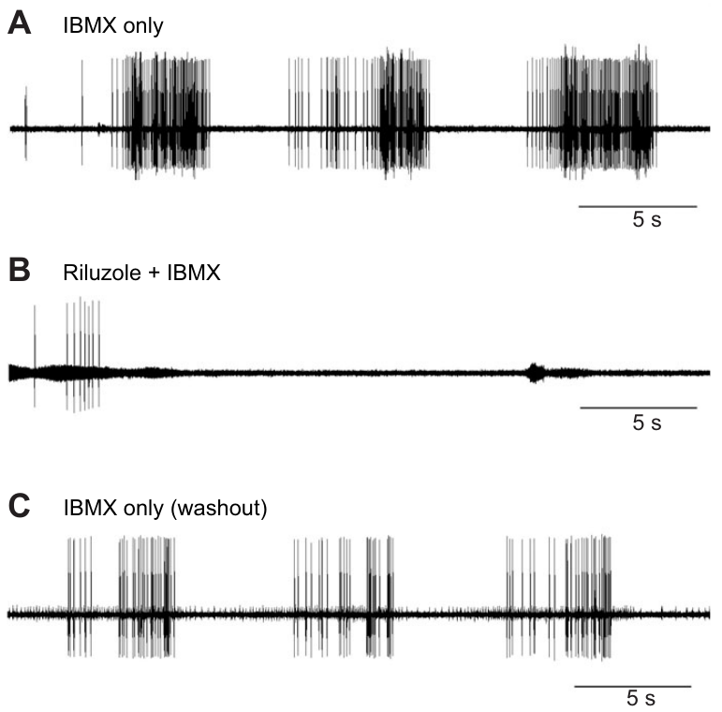
Persistent sodium entry contributes to induced bursting
Crisp and colleagues tested IBMX-induced bursting with riluzole, a drug used to inhibit a persistent sodium-current component. A persistent current continues beyond the brief inward current associated with an action potential. Sustained sodium entry can support a prolonged depolarization on which spikes occur.
Application of 200 μM riluzole stopped the rhythmic DE-3 bursts despite continued IBMX exposure. The preparations could still fire impulses, and washing out riluzole while retaining IBMX restored bursting. The within-preparation recovery distinguishes rhythm disruption from irreversible loss of neuronal viability.
Ashaber et al. (2021), Fig. 7(a). Reconstructed DE-3 arbor over a dorsal micro-CT image.
The result supports a sodium-dependent contribution to the induced timing mechanism. Riluzole stopped bursting even though IBMX continued to act, so the sodium-dependent process works downstream of, or in parallel with, the cAMP signal in setting the crawl rhythm.
Crisp et al. (2012), Fig. 2(A–C). IBMX-induced bursts, riluzole blockade and washout recovery.
Crisp et al. (2012); Ashaber et al. (2021)
33
Notes:
Teaching transcript:
Crisp and colleagues tested IBMX-induced bursting with riluzole, a drug used to inhibit a persistent sodium-current component. A persistent current continues beyond the brief inward current associated with an action potential. Sustained sodium entry can support a prolonged depolarization on which spikes occur.
Application of 200 μM riluzole stopped the rhythmic DE-3 bursts despite continued IBMX exposure. The preparations could still fire impulses, and washing out riluzole while retaining IBMX restored bursting. The within-preparation recovery distinguishes rhythm disruption from irreversible loss of neuronal viability.
The result supports a sodium-dependent contribution to the induced timing mechanism. It does not directly measure the persistent current in an identified oscillator neuron or establish a channel gene. Pharmacological sensitivity and preserved spiking constrain the explanation without completing its molecular identification.
Riluzole was applied at 200 μM. Continued action potentials after loss of repetitive bursting help separate excitability from the slower dynamics that generate a rhythm; pharmacology still cannot establish the responsible sodium-channel gene.
References:
K. M. Crisp; B. R. Gallagher; K. A. Mesce (2012). Mechanisms contributing to the dopamine induction of crawl-like bursting in leech motoneurons. Journal of Experimental Biology 215(17):3028–3036. https://doi.org/10.1242/jeb.069245
M. Ashaber; Y. Tomina; P. Kassraian; E. A. Bushong; W. B. Kristan Jr; M. H. Ellisman; D. A. Wagenaar (2021). Anatomy and activity patterns in a multifunctional motor neuron and its surrounding circuits. eLife 10:e61881. https://doi.org/10.7554/eLife.61881
Crisp et al. (2012), Fig. 2(A–C). IBMX-induced bursts, riluzole blockade and washout recovery.
Figure source: https://doi.org/10.1242/jeb.069245
Ashaber et al. (2021), Fig. 7(a). Reconstructed DE-3 arbor over a dorsal micro-CT image.
Figure source: https://doi.org/10.7554/eLife.61881

Slide 43
Crawl-like bursting persists without normal calcium influx
Crisp and colleagues replaced extracellular calcium with an equimolar concentration of nickel or cobalt while testing theophylline-induced DE-3 bursting. Calcium entry normally participates in several membrane and synaptic processes. Ion substitution tested whether normal calcium influx was required for the observed rhythmic output.
Bursting persisted in saline with 1.8 mM nickel replacing 1.8 mM calcium. Example average cycle periods were approximately 20.4 s in calcium-containing saline and 22.3 s in nickel-containing saline. Burst durations also remained in a similar range.
Ashaber et al. (2021), Fig. 7(a). Reconstructed DE-3 arbor over a dorsal micro-CT image.
These observations favor a timing contribution that can operate without normal calcium entry under the experimental treatment. Nickel and cobalt block calcium channels as well as replacing calcium, so persistent bursting points toward the sodium-dependent process blocked by riluzole as the main source of burst timing.
Crisp et al. (2012), Fig. 1(B). Original comparison of induced burst timing across treatments.
Crisp et al. (2012); Ashaber et al. (2021)
34
Notes:
Teaching transcript:
Crisp and colleagues replaced extracellular calcium with an equimolar concentration of nickel or cobalt while testing theophylline-induced DE-3 bursting. Calcium entry normally participates in several membrane and synaptic processes. Ion substitution tested whether normal calcium influx was required for the observed rhythmic output.
Bursting persisted in saline with 1.8 mM nickel replacing 1.8 mM calcium. Example average cycle periods were approximately 20.4 s in calcium-containing saline and 22.3 s in nickel-containing saline. Burst durations also remained in a similar range.
These observations favor a timing contribution that can operate without normal calcium entry under the experimental treatment. They do not imply that calcium is unnecessary for every synapse or for natural crawling. Ion substitution alters several processes, and the result must remain specific to the drug-induced bursting tested in the isolated preparation.
The comparative timing panel contextualizes the induced bursts, while the ion-replacement result is reported in the article text. The timing comparison does not independently test the ion-replacement condition.
References:
K. M. Crisp; B. R. Gallagher; K. A. Mesce (2012). Mechanisms contributing to the dopamine induction of crawl-like bursting in leech motoneurons. Journal of Experimental Biology 215(17):3028–3036. https://doi.org/10.1242/jeb.069245
M. Ashaber; Y. Tomina; P. Kassraian; E. A. Bushong; W. B. Kristan Jr; M. H. Ellisman; D. A. Wagenaar (2021). Anatomy and activity patterns in a multifunctional motor neuron and its surrounding circuits. eLife 10:e61881. https://doi.org/10.7554/eLife.61881
Crisp et al. (2012), Fig. 1(B). Original comparison of induced burst timing across treatments.
Figure source: https://doi.org/10.1242/jeb.069245
Ashaber et al. (2021), Fig. 7(a). Reconstructed DE-3 arbor over a dorsal micro-CT image.
Figure source: https://doi.org/10.7554/eLife.61881

Slide 44
Potassium-current blockade changes the active fraction
Crisp and colleagues tested clotrimazole, a blocker associated with intermediate-conductance calcium-dependent potassium channels. Potassium efflux generally opposes depolarization under these conditions. Removing an outward current can therefore alter how long an excitable cell remains active during a burst.
At 25 μM clotrimazole, DE-3 bursts occurred with cycle periods near 20 s, comparable to the other induction methods. Their duration increased to approximately 13.5 s, compared with approximately 5 s under dopamine or phosphodiesterase inhibition. The active fraction of the cycle was consequently much larger.
Ashaber et al. (2021), Fig. 7(a). Reconstructed DE-3 arbor over a dorsal micro-CT image.
The result separates period from burst termination and supports an outward-current contribution to pattern shape. With DE-3 active for most of each cycle, longitudinal contraction would leave little time for elongation, so normal crawling depends on mechanisms that end each burst on time.
Crisp et al. (2012), Fig. 1(B). Published burst-period and burst-duration comparison.
Crisp et al. (2012); Ashaber et al. (2021)
35
Notes:
Teaching transcript:
Crisp and colleagues tested clotrimazole, a blocker associated with intermediate-conductance calcium-dependent potassium channels. Potassium efflux generally opposes depolarization under these conditions. Removing an outward current can therefore alter how long an excitable cell remains active during a burst.
At 25 μM clotrimazole, DE-3 bursts occurred with cycle periods near 20 s, comparable to the other induction methods. Their duration increased to approximately 13.5 s, compared with approximately 5 s under dopamine or phosphodiesterase inhibition. The active fraction of the cycle was consequently much larger.
The result separates period from burst termination and supports an outward-current contribution to pattern shape. Clotrimazole can also affect sodium–potassium pump activity, so this experiment does not uniquely identify one potassium-channel subtype as the endogenous dopamine target. The channel account remains pharmacologically supported and incomplete.
The sodium–potassium pump uses energy to maintain ionic gradients and can contribute an outward electrical effect. A drug that influences both a channel and the pump requires caution when assigning its entire physiological effect to one target.
References:
K. M. Crisp; B. R. Gallagher; K. A. Mesce (2012). Mechanisms contributing to the dopamine induction of crawl-like bursting in leech motoneurons. Journal of Experimental Biology 215(17):3028–3036. https://doi.org/10.1242/jeb.069245
M. Ashaber; Y. Tomina; P. Kassraian; E. A. Bushong; W. B. Kristan Jr; M. H. Ellisman; D. A. Wagenaar (2021). Anatomy and activity patterns in a multifunctional motor neuron and its surrounding circuits. eLife 10:e61881. https://doi.org/10.7554/eLife.61881
Crisp et al. (2012), Fig. 1(B). Published burst-period and burst-duration comparison.
Figure source: https://doi.org/10.1242/jeb.069245
Ashaber et al. (2021), Fig. 7(a). Reconstructed DE-3 arbor over a dorsal micro-CT image.
Figure source: https://doi.org/10.7554/eLife.61881

Slide 45
Separate currents set when a crawl burst starts and stops
A rhythmic burst needs processes that start, sustain and end depolarization. A persistent sodium current suits the first two roles: once it activates near threshold, its inward flow depolarizes the membrane further, which keeps more channels open and supports a plateau lasting seconds on which spikes ride.
Outward potassium current that grows during the plateau pulls the membrane back toward rest, and the burst ends when outward current outweighs inward. The pharmacology fits this division: riluzole removed bursts but not single spikes, clotrimazole stretched bursts to about 13.5 s with a period still near 20 s, and nickel replacing calcium left the timing intact.
Separate control of onset and termination gives the crawl circuit two adjustable dimensions: inward drive sets whether and how often bursts occur, and termination sets how much of each cycle is spent contracting.
Crisp et al. (2012), Fig. 2(A–C). IBMX-induced bursts, riluzole blockade and washout recovery.
Crisp et al. (2012)
35a
Notes:
Slides 31 to 35 test one drug or ion substitution at a time; combined, they outline a burst mechanism with a sodium-dependent start and a potassium-dependent end.
Positive feedback sustains the plateau.
A persistent sodium current does not inactivate quickly, so depolarization that opens it is reinforced for as long as the membrane stays depolarized.
Crisp and colleagues suggest that phosphodiesterase inhibitors and dopamine activate a sodium-influx-dependent timing mechanism capable of setting the crawl rhythm.
Outward current terminates the burst.
Clotrimazole on slide 35 blocks intermediate-conductance calcium-dependent potassium channels, and with that outward current reduced, bursts lasted far longer while cycles kept roughly the same length.
Riluzole on slide 33 had the complementary effect, abolishing rhythmic bursting while leaving impulse generation intact.
Calcium entry is not the timer.
Bursting persisted when cobalt or nickel replaced calcium, as slide 34 reports, which points away from calcium influx as the rhythm-setting step.
The remaining candidates, sodium entry and potassium exit, match the riluzole and clotrimazole results.
References:
K. M. Crisp; B. R. Gallagher; K. A. Mesce (2012). Mechanisms contributing to the dopamine induction of crawl-like bursting in leech motoneurons. Journal of Experimental Biology 215(17):3028–3036. https://doi.org/10.1242/jeb.069245

Slide 46
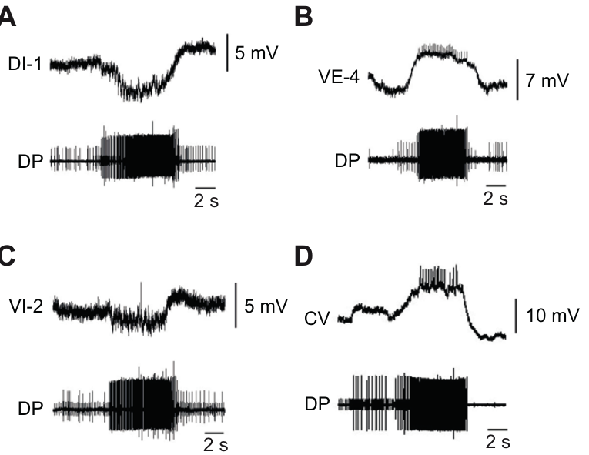
A slow rhythm can retain the wrong motor-cell phase
Crisp and colleagues recorded several identified motor cells while IBMX induced DE-3 bursts in isolated ganglia. This tested whether a drug that reproduced approximate crawl timing also reproduced the full crawl motor pattern. Simultaneous intracellular and motor-nerve recordings established relative phase within the same cycle.
The longitudinal excitor VE-4 depolarized with DE-3, while inhibitors DI-1 and VI-2 were hyperpolarized during those bursts. However, the circular excitor CV fired in phase with DE-3 under IBMX. During the usual dopamine-induced crawl pattern, CV instead participates in the opposing elongation phase.
Crisp et al. (2012), Fig. 3(A–D). Identified motor-cell activity during IBMX-induced bursting.
Rhythm generation and correct motor patterning are separable. A CV burst during contraction would make circular muscles squeeze while longitudinal muscles shorten the segment, opposing actions that cancel rather than alternate. Dopamine must therefore act beyond the timing route to place CV in the elongation phase.
Ashaber et al. (2021), Fig. 7(a). Reconstructed DE-3 arbor over a dorsal micro-CT image.
Crisp et al. (2012); Ashaber et al. (2021)
36
Notes:
Teaching transcript:
Crisp and colleagues recorded several identified motor cells while IBMX induced DE-3 bursts in isolated ganglia. This tested whether a drug that reproduced approximate crawl timing also reproduced the full crawl motor pattern. Simultaneous intracellular and motor-nerve recordings established relative phase within the same cycle.
The longitudinal excitor VE-4 depolarized with DE-3, while inhibitors DI-1 and VI-2 were hyperpolarized during those bursts. However, the circular excitor CV fired in phase with DE-3 under IBMX. During the usual dopamine-induced crawl pattern, CV instead participates in the opposing elongation phase.
Rhythm generation and correct motor patterning are separable. Reproducing a slow period does not establish that every muscle group will be activated appropriately. The mismatch supports additional dopamine actions beyond the phosphodiesterase-sensitive timing route, without identifying all of the responsible receptor subtypes or interneurons.
If circular and longitudinal excitors fire together, their usual antagonistic mechanical actions can conflict. The preparation records neural outputs rather than intact muscle deformation, so the predicted movement consequence remains distinct from the measured phase error.
References:
K. M. Crisp; B. R. Gallagher; K. A. Mesce (2012). Mechanisms contributing to the dopamine induction of crawl-like bursting in leech motoneurons. Journal of Experimental Biology 215(17):3028–3036. https://doi.org/10.1242/jeb.069245
M. Ashaber; Y. Tomina; P. Kassraian; E. A. Bushong; W. B. Kristan Jr; M. H. Ellisman; D. A. Wagenaar (2021). Anatomy and activity patterns in a multifunctional motor neuron and its surrounding circuits. eLife 10:e61881. https://doi.org/10.7554/eLife.61881
Crisp et al. (2012), Fig. 3(A–D). Identified motor-cell activity during IBMX-induced bursting.
Figure source: https://doi.org/10.1242/jeb.069245
Ashaber et al. (2021), Fig. 7(a). Reconstructed DE-3 arbor over a dorsal micro-CT image.
Figure source: https://doi.org/10.7554/eLife.61881

Slide 47
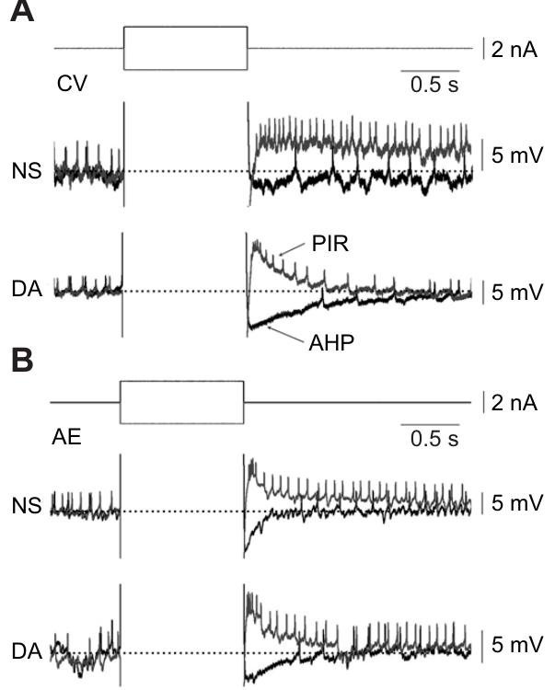
Dopamine reshapes rebound after inhibition
Crisp and colleagues applied hyperpolarizing current pulses to CV and AE motor neurons before and during dopamine exposure. Post-inhibitory rebound is increased depolarization or firing after an inhibitory influence ends. An afterhyperpolarization is a more negative voltage following activity or a rebound response.
At 75 μM dopamine, CV had a larger rebound peak but a shorter rebound duration and enhanced afterhyperpolarization. AE also had a shortened rebound response. Current pulses of −1 nA for 500 ms provided a defined perturbation rather than relying on variable network inhibition.
Ashaber et al. (2021), Fig. 7(a). Reconstructed DE-3 arbor over a dorsal micro-CT image.
Peak voltage, response duration, and subsequent inhibition can change differently under one modulator. Dopamine shortened rebound in both CV and AE, two motor neurons active during crawling, so the modulator alters how crawl motor neurons recover from inhibition rather than acting on a single cell.
Crisp et al. (2012), Fig. 4(A,B). Current pulses and rebound responses in CV and AE.
Crisp et al. (2012); Ashaber et al. (2021)
37
Notes:
Teaching transcript:
Crisp and colleagues applied hyperpolarizing current pulses to CV and AE motor neurons before and during dopamine exposure. Post-inhibitory rebound is increased depolarization or firing after an inhibitory influence ends. An afterhyperpolarization is a more negative voltage following activity or a rebound response.
At 75 μM dopamine, CV had a larger rebound peak but a shorter rebound duration and enhanced afterhyperpolarization. AE also had a shortened rebound response. Current pulses of −1 nA for 500 ms provided a defined perturbation rather than relying on variable network inhibition.
The effect shows that peak voltage, response duration, and subsequent inhibition can change differently under one modulator. It does not support a simple rule that dopamine uniformly increases excitability. The channel processes responsible for each component were not isolated directly by these current-pulse measurements.
A sharper but shorter rebound can change when a motor neuron fires without increasing its total activity. The experiment measures the cell’s response to a controlled input, while its actual phase in the network also depends on synaptic drive.
References:
K. M. Crisp; B. R. Gallagher; K. A. Mesce (2012). Mechanisms contributing to the dopamine induction of crawl-like bursting in leech motoneurons. Journal of Experimental Biology 215(17):3028–3036. https://doi.org/10.1242/jeb.069245
M. Ashaber; Y. Tomina; P. Kassraian; E. A. Bushong; W. B. Kristan Jr; M. H. Ellisman; D. A. Wagenaar (2021). Anatomy and activity patterns in a multifunctional motor neuron and its surrounding circuits. eLife 10:e61881. https://doi.org/10.7554/eLife.61881
Crisp et al. (2012), Fig. 4(A,B). Current pulses and rebound responses in CV and AE.
Figure source: https://doi.org/10.1242/jeb.069245
Ashaber et al. (2021), Fig. 7(a). Reconstructed DE-3 arbor over a dorsal micro-CT image.
Figure source: https://doi.org/10.7554/eLife.61881

Slide 48
Rebound from inhibition can place CV in the elongation phase
During dopamine-induced crawling, CV is hyperpolarized while DE-3 bursts and fires once contraction ends. Post-inhibitory rebound can time that firing: when inhibition lifts, channels that recovered during hyperpolarization carry inward current that briefly drives the cell above threshold.
Dopamine's effects would sharpen this switch. A taller rebound peak makes CV fire promptly as inhibition lifts, while a shorter rebound and stronger afterhyperpolarization end its burst before the following contraction. With lower excitability to steady current, CV fires mainly on release from inhibition.
Phosphodiesterase inhibitors raised resting discharge instead, and CV fired with DE-3. Correct crawl patterning therefore depends on dopamine acting on motor-neuron membranes as well as on the rhythm-setting route.
Crisp et al. (2012), Fig. 4(A,B). Current pulses and rebound responses in CV and AE.
Crisp et al. (2012); Puhl & Mesce (2008)
37a
Notes:
Slide 27 gives CV's phase during normal fictive crawling, slide 36 reports that phase lost under IBMX, and slides 37 and 38 show what dopamine does to CV's membrane; together they suggest how CV is timed.
CV's timing follows inhibition.
Puhl and Mesce recorded a hyperpolarization of a few millivolts in CV during each DE-3 burst, with CV firing in the opposite half of the cycle.
A neuron that fires as soon as inhibition ends will automatically sit in the phase after contraction, which is elongation.
Dopamine tunes the rebound.
With dopamine present, CV's rebound after a current pulse peaked higher but lasted less time, followed by a deeper afterhyperpolarization.
A brief, strong rebound produces a well-timed burst that does not spill into the following contraction.
The PDI comparison supports the idea.
Crisp and colleagues report that dopamine lowered motoneuron excitability, whereas phosphodiesterase inhibitors increased resting discharge rates.
They propose that multiple dopamine receptor subtypes shape the phase relationships and membrane properties of particular crawl neurons, which would explain why CV's phase is restored only by dopamine.
References:
K. M. Crisp; B. R. Gallagher; K. A. Mesce (2012). Mechanisms contributing to the dopamine induction of crawl-like bursting in leech motoneurons. Journal of Experimental Biology 215(17):3028–3036. https://doi.org/10.1242/jeb.069245
J. G. Puhl; K. A. Mesce (2008). Dopamine activates the motor pattern for crawling in the medicinal leech. Journal of Neuroscience 28(16):4192–4200. https://doi.org/10.1523/JNEUROSCI.0136-08.2008

Slide 49
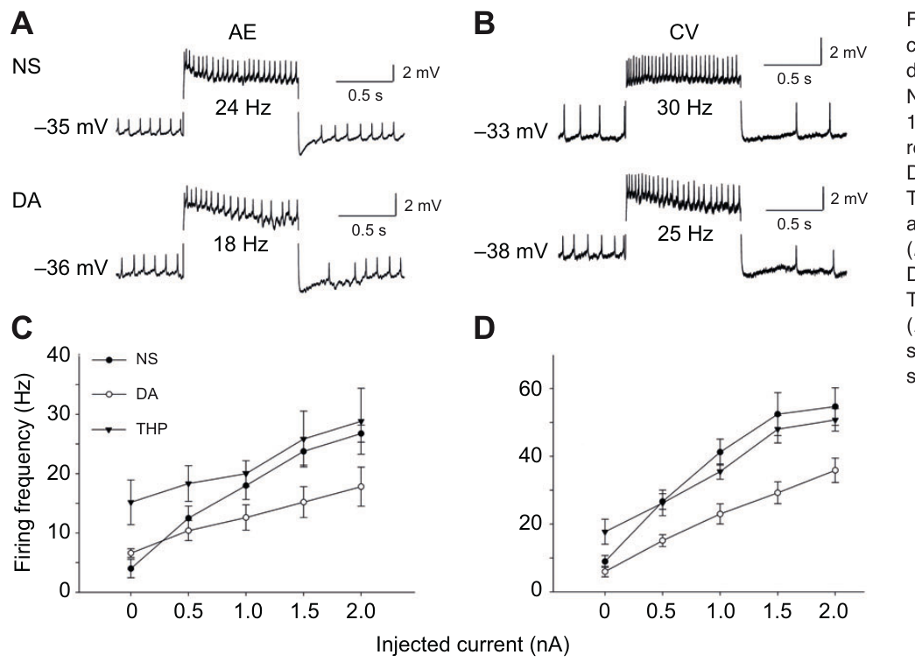
Dopamine can promote pattern while reducing excitability
Crisp and colleagues injected depolarizing current into CV and AE and compared firing before and during dopamine exposure. Excitability here refers to the relationship between injected current and the resulting discharge. Testing that relationship separates direct cellular responsiveness from the presence of a network rhythm.
For a +1 nA input, average AE firing fell from approximately 18 to 12.6 Hz during dopamine; average CV firing fell from approximately 41.2 to 23 Hz. Theophylline did not reproduce the same reduction and instead increased resting discharge in the tested cells.
Dopamine can favor a patterned output while reducing the response of particular motor neurons to steady excitation. Timing, phase, and input responsiveness are different properties. The contrast with theophylline indicates dopamine actions beyond cAMP elevation, consistent with several dopamine receptor subtypes acting on crawl motor neurons.
Crisp et al. (2012), Fig. 5(A–D). Motor-cell firing responses and original current–frequency plots.
Ashaber et al. (2021), Fig. 7(a). Reconstructed DE-3 arbor over a dorsal micro-CT image.
Crisp et al. (2012); Ashaber et al. (2021)
38
Notes:
Teaching transcript:
Crisp and colleagues injected depolarizing current into CV and AE and compared firing before and during dopamine exposure. Excitability here refers to the relationship between injected current and the resulting discharge. Testing that relationship separates direct cellular responsiveness from the presence of a network rhythm.
For a +1 nA input, average AE firing fell from approximately 18 to 12.6 Hz during dopamine; average CV firing fell from approximately 41.2 to 23 Hz. Theophylline did not reproduce the same reduction and instead increased resting discharge in the tested cells.
Dopamine can favor a patterned output while reducing the response of particular motor neurons to steady excitation. Timing, phase, and input responsiveness are different properties. The mismatch with theophylline supports multiple modulatory effects, but does not prove which receptor or conductance accounts for each difference.
The traces in the original figure represent individual examples, while the text here uses the article’s average current-response values. The distinction prevents an illustrative trace from being treated as the population average.
References:
K. M. Crisp; B. R. Gallagher; K. A. Mesce (2012). Mechanisms contributing to the dopamine induction of crawl-like bursting in leech motoneurons. Journal of Experimental Biology 215(17):3028–3036. https://doi.org/10.1242/jeb.069245
M. Ashaber; Y. Tomina; P. Kassraian; E. A. Bushong; W. B. Kristan Jr; M. H. Ellisman; D. A. Wagenaar (2021). Anatomy and activity patterns in a multifunctional motor neuron and its surrounding circuits. eLife 10:e61881. https://doi.org/10.7554/eLife.61881
Crisp et al. (2012), Fig. 5(A–D). Motor-cell firing responses and original current–frequency plots.
Figure source: https://doi.org/10.1242/jeb.069245
Ashaber et al. (2021), Fig. 7(a). Reconstructed DE-3 arbor over a dorsal micro-CT image.
Figure source: https://doi.org/10.7554/eLife.61881

Slide 50
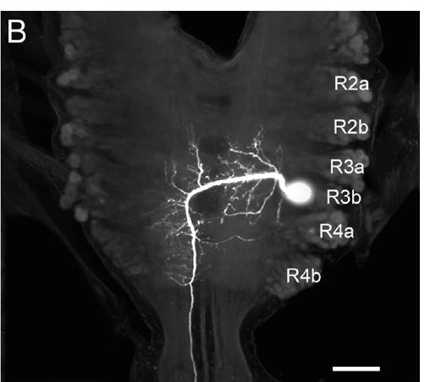
A descending neuron reaches distributed crawl circuitry
Puhl and colleagues identified the paired descending neuron R3b-1 within the subesophageal ganglion. A descending projection carries signals from an anterior neural region toward more posterior circuitry. Neurobiotin filling and confocal imaging established the cell’s soma and arborization in the cephalic region.
R3b-1 has an axon that extends through the nerve cord, with branches in segmental ganglia. Some processes cross the midline, providing anatomical access to both sides. The published cephalic and segmental images preserve 100 μm scale bars.
The anatomy permits one cell to influence many local motor circuits. A single axon that runs uninterrupted through the cord and branches in each hemiganglion can deliver the same signal to every segmental crawl generator, an arrangement suited to starting and coordinating all segments together.
Puhl et al. (2012), Fig. 2(B). Confocal anatomy of the identified descending R3b-1 neuron.
Puhl et al. (2012)
39
Notes:
Teaching transcript:
Puhl and colleagues identified the paired descending neuron R3b-1 within the subesophageal ganglion. A descending projection carries signals from an anterior neural region toward more posterior circuitry. Neurobiotin filling and confocal imaging established the cell’s soma and arborization in the cephalic region.
R3b-1 has an axon that extends through the nerve cord, with branches in segmental ganglia. Some processes cross the midline, providing anatomical access to both sides. The published cephalic and segmental images preserve 100 μm scale bars.
The anatomy permits one cell to influence many local motor circuits, but a visible arbor is not proof of a synapse onto every nearby neuron. Its functional role must be tested with recording and perturbation. The descending arrangement also does not make R3b-1 the sole possible source of local crawl rhythmicity.
The subesophageal ganglion is a fused cephalic neural region below the esophagus. The bilateral pairing matters because manipulating one cell without excluding its counterpart could leave a parallel source of descending influence.
References:
J. G. Puhl; M. A. Masino; K. A. Mesce (2012). Necessary, sufficient and permissive: a single locomotor command neuron important for intersegmental coordination. Journal of Neuroscience 32(49):17646–17657. https://doi.org/10.1523/JNEUROSCI.2249-12.2012
Puhl et al. (2012), Fig. 2(B). Confocal anatomy of the identified descending R3b-1 neuron.
Figure source: https://doi.org/10.1523/JNEUROSCI.2249-12.2012

Slide 51
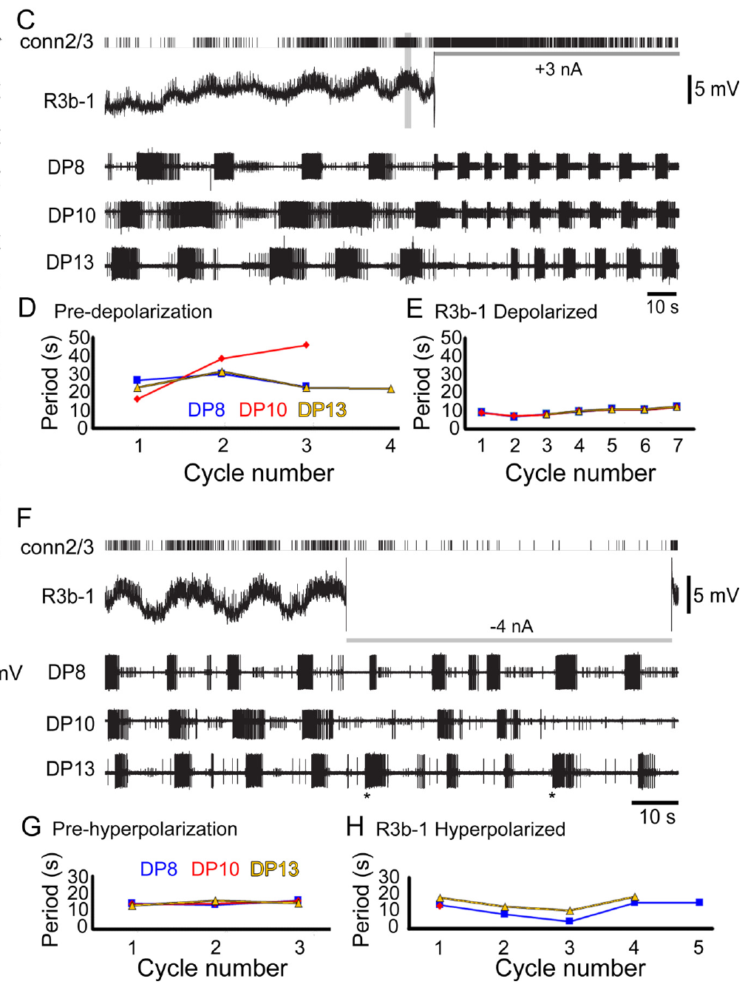
R3b-1 activity controls coordination in a defined state
Puhl and colleagues excluded the contralateral R3b-1 influence and recorded DE-3 output from several segments while manipulating the remaining cell. Dopamine biased the preparation toward crawling. This design tested one descending neuron’s effect on a distributed rhythm under specified conditions.
A +3 nA current increased R3b-1 spiking and converted irregular segmental bursting into coordinated fictive crawling. In one example, periods changed from roughly 27–29 s to approximately 10 s across the recording sites. A −4 nA current disrupted their common period and crawl-specific coordination, even when some local bursts continued.
R3b-1 activity was sufficient and necessary for coordinated output in the tested preparation and state, the strict definition of a command neuron. R3b-1 also modulated the cycle period, so beyond starting crawling it adjusts how fast the segmental oscillators run.
Puhl et al. (2012), Fig. 4(C–H). Depolarization and hyperpolarization with multisegment recordings.
Puhl et al. (2012)
40
Notes:
Teaching transcript:
Puhl and colleagues excluded the contralateral R3b-1 influence and recorded DE-3 output from several segments while manipulating the remaining cell. Dopamine biased the preparation toward crawling. This design tested one descending neuron’s effect on a distributed rhythm under specified conditions.
A +3 nA current increased R3b-1 spiking and converted irregular segmental bursting into coordinated fictive crawling. In one example, periods changed from roughly 27–29 s to approximately 10 s across the recording sites. A −4 nA current disrupted their common period and crawl-specific coordination, even when some local bursts continued.
R3b-1 activity was sufficient and necessary for coordinated output in the tested preparation and state. Local burst persistence prevents equating disruption of coordination with complete abolition of every segmental oscillator. The result is a conditional causal role, not a universal claim that this cell is required for all rhythms under all conditions.
The extracellular connective recording verified changes in R3b-1 spiking during intracellular current injection. This control separates an intended voltage manipulation from evidence that the neuron’s propagated activity actually changed.
References:
J. G. Puhl; M. A. Masino; K. A. Mesce (2012). Necessary, sufficient and permissive: a single locomotor command neuron important for intersegmental coordination. Journal of Neuroscience 32(49):17646–17657. https://doi.org/10.1523/JNEUROSCI.2249-12.2012
Puhl et al. (2012), Fig. 4(C–H). Depolarization and hyperpolarization with multisegment recordings.
Figure source: https://doi.org/10.1523/JNEUROSCI.2249-12.2012

Slide 52
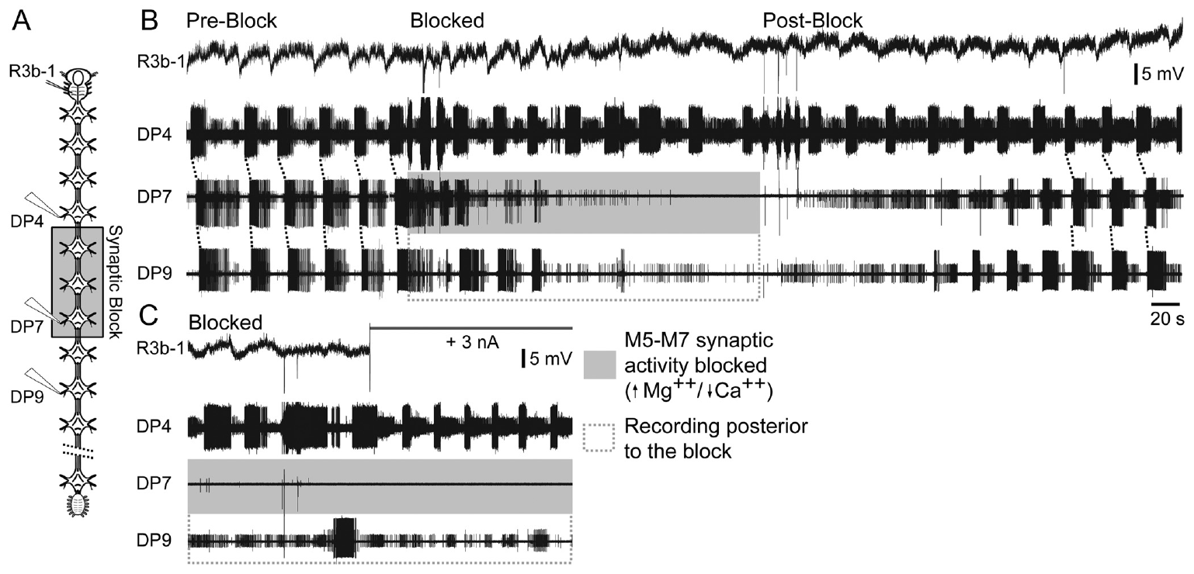
A command signal must interact with segmental networks
Puhl and colleagues tested whether R3b-1 commands coordination directly or must interact with local segmental circuits. High-magnesium, low-calcium saline blocked chemical transmission in a restricted region while the axon remained capable of conducting. Motor recordings sampled ganglia within and outside the blocked region.
The synaptic blockade altered the coordinated pattern. Depolarizing R3b-1 did not restore ordinary crawl coordination simply by sending more descending spikes through the affected region. Appropriate rhythmic activity could remain elsewhere without the expected full intersegmental organization.
A permissive signal enables a local network to operate rather than specifying every event independently. Coordination therefore emerges from R3b-1 acting through chemical synapses within the ganglia it reaches, so descending and segmental circuits produce coordinated crawling jointly.
Puhl et al. (2012), Fig. 6(A–C). Regional synaptic blockade during descending-neuron stimulation.
Puhl et al. (2012)
41
Notes:
Teaching transcript:
Puhl and colleagues tested whether R3b-1 commands coordination directly or must interact with local segmental circuits. High-magnesium, low-calcium saline blocked chemical transmission in a restricted region while the axon remained capable of conducting. Motor recordings sampled ganglia within and outside the blocked region.
The synaptic blockade altered the coordinated pattern. Depolarizing R3b-1 did not restore ordinary crawl coordination simply by sending more descending spikes through the affected region. Appropriate rhythmic activity could remain elsewhere without the expected full intersegmental organization.
A permissive signal enables a local network to operate rather than specifying every event independently. The results support cooperation between descending input and segmental circuitry. Regional saline blockade affects many synapses, so it does not identify a single local relay or prove that every coordinating interaction is chemical.
In this experiment, preserving axonal conduction while reducing synaptic transmission made it possible to distinguish passage of the command neuron’s signal from successful interaction with the circuits that organize the rhythm.
References:
J. G. Puhl; M. A. Masino; K. A. Mesce (2012). Necessary, sufficient and permissive: a single locomotor command neuron important for intersegmental coordination. Journal of Neuroscience 32(49):17646–17657. https://doi.org/10.1523/JNEUROSCI.2249-12.2012
Puhl et al. (2012), Fig. 6(A–C). Regional synaptic blockade during descending-neuron stimulation.
Figure source: https://doi.org/10.1523/JNEUROSCI.2249-12.2012

Slide 53
Dopamine decides which program R3b-1 commands
R3b-1 was first known as a neuron whose stimulation could start swimming. After the nervous system was exposed to dopamine, stimulating it produced crawling only. The same descending cell, reaching the same segmental ganglia, elicits different behaviors depending on the chemical state of the cord.
Dopamine acts at both ends of this pathway. In the segmental ganglia it activates the crawl generators, as the single-ganglion experiments revealed. In R3b-1 itself, dopamine induced bursting at crawl-like periods even after ascending input from the crawl oscillators was removed, so the command neuron's own firing pattern is matched to crawling.
Such a context signal allows one descending pathway to start locomotion while the modulatory state chooses the gait. Serotonin's promotion of swimming and dopamine's promotion of crawling fit this arrangement, with each amine biasing the shared segmental circuits toward one program.
Puhl et al. (2012), Fig. 2(B). Confocal anatomy of the identified descending R3b-1 neuron.
Puhl et al. (2012); Puhl & Mesce (2008)
41a
Notes:
Slides 39 to 41 study R3b-1 in dopamine-treated cords; the paper's broader findings explain why the dopamine context matters for what this command neuron does.
One neuron, two behaviors.
Puhl and colleagues report that R3b-1 had previously been shown to activate swimming, but with dopamine present crawling became the exclusive locomotor pattern it produced.
The neuron therefore does not encode a single movement; it activates whichever program the state of the cord favors.
Dopamine shapes the command neuron as well as its targets.
Dopamine exposure produced bursting in R3b-1 with periods matching fictive crawling, even when ascending inputs from crawl oscillators were removed.
Its targets, the segmental crawl generators of slide 28, are activated by dopamine independently of any descending input.
Amines act as internal context.
The authors describe dopamine as an internal contextual cue that integrates functional layers of the nervous system for adaptive behavior.
Serotonin's effect on swim readiness on slide 16 is the counterpart for the other gait.
References:
J. G. Puhl; M. A. Masino; K. A. Mesce (2012). Necessary, sufficient and permissive: a single locomotor command neuron important for intersegmental coordination. Journal of Neuroscience 32(49):17646–17657. https://doi.org/10.1523/JNEUROSCI.2249-12.2012
J. G. Puhl; K. A. Mesce (2008). Dopamine activates the motor pattern for crawling in the medicinal leech. Journal of Neuroscience 28(16):4192–4200. https://doi.org/10.1523/JNEUROSCI.0136-08.2008
A. L. Willard (1981). Effects of serotonin on the generation of the motor program for swimming by the medicinal leech. Journal of Neuroscience 1(9):936–944. https://doi.org/10.1523/JNEUROSCI.01-09-00936.1981

Slide 54
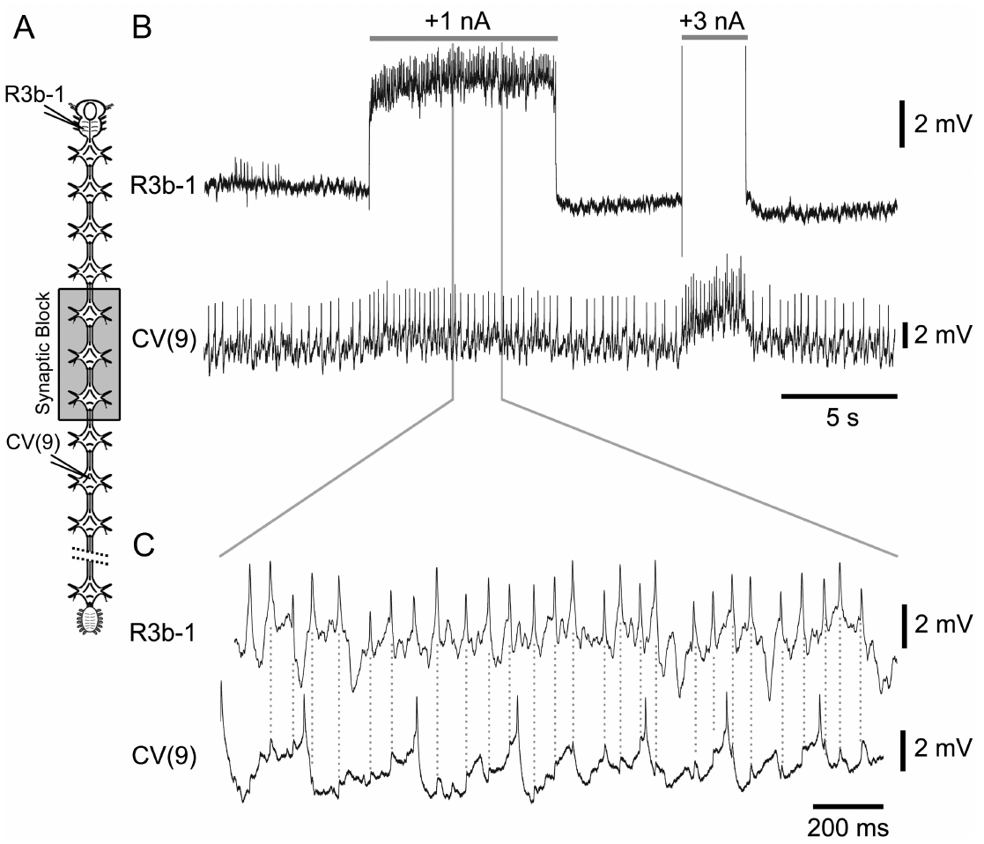
A motor follower tests a specific descending connection
Puhl and colleagues recorded R3b-1 together with CV while applying regional synaptic blockade and stimulating the descending cell. CV is a crawl-related circular-muscle excitor. A defined presynaptic spike train permits testing a more specific connection than simply observing that both cells oscillate during crawling.
R3b-1 stimulation produced excitatory responses in CV consistent with a synaptic follower relationship. The published expanded recording retains the relationship between the descending spike and the subsequent motor-cell potential. Comparing the response under reduced-transmission conditions supplied evidence about the connecting route.
This supports a functional pathway from descending input to a motor output associated with elongation. Driving CV gives R3b-1 a route into the phase that begins each crawl step, which fits its roles in starting crawling and pacing the crawl cycle.
Puhl et al. (2012), Fig. 7(A–C). R3b-1 stimulation and the response of circular excitor CV.
Puhl et al. (2012)
42
Notes:
Teaching transcript:
Puhl and colleagues recorded R3b-1 together with CV while applying regional synaptic blockade and stimulating the descending cell. CV is a crawl-related circular-muscle excitor. A defined presynaptic spike train permits testing a more specific connection than simply observing that both cells oscillate during crawling.
R3b-1 stimulation produced excitatory responses in CV consistent with a synaptic follower relationship. The published expanded recording retains the relationship between the descending spike and the subsequent motor-cell potential. Comparing the response under reduced-transmission conditions supplied evidence about the connecting route.
This supports a functional pathway from descending input to a motor output associated with elongation. It does not establish that R3b-1 directly controls every crawl neuron or that this connection alone generates the entire rhythm. The broader pattern still depends on interactions among local circuits and motor pathways.
An excitatory postsynaptic potential is a voltage change that promotes firing in a receiving neuron. A reproducible response to a defined presynaptic event is stronger evidence for connectivity than a shared phase during a long motor episode.
References:
J. G. Puhl; M. A. Masino; K. A. Mesce (2012). Necessary, sufficient and permissive: a single locomotor command neuron important for intersegmental coordination. Journal of Neuroscience 32(49):17646–17657. https://doi.org/10.1523/JNEUROSCI.2249-12.2012
Puhl et al. (2012), Fig. 7(A–C). R3b-1 stimulation and the response of circular excitor CV.
Figure source: https://doi.org/10.1523/JNEUROSCI.2249-12.2012

Slide 55
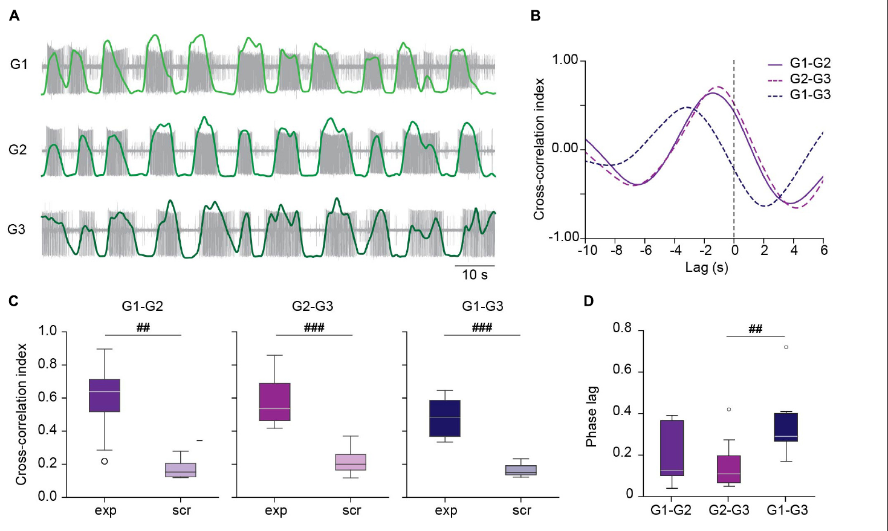
Short ganglion chains can coordinate without the brain
Kearney and colleagues studied dopamine-induced crawling in isolated chains of three ganglia. This preparation lacked both the cephalic brain and the moving peripheral body. Motor-nerve recordings tested whether local circuits could express a coordinated sequence through their remaining central connections.
DE-3 bursts followed a consistent order through the chain, with a median phase lag near 0.12 of a cycle per segment. Combining recordings from different chains in a scrambled control eliminated the strong temporal relationship. The coordination therefore could not be explained simply by independent rhythms of similar average frequency.
Kearney et al. (2022), Fig. 3(A–D). Measured chain activity and scrambled-recording comparisons.
The result establishes central coordination without a descending command in this reduced context. In intact crawling leeches Kearney and colleagues measured a phase lag near 0.03 per segment and a period near 5 s, against about 10 s in chains, so descending and sensory signals speed both coordination and rhythm.
Ashaber et al. (2021), Fig. 7(a). Reconstructed DE-3 arbor over a dorsal micro-CT image.
Kearney et al. (2022); Ashaber et al. (2021)
43
Notes:
Teaching transcript:
Kearney and colleagues studied dopamine-induced crawling in isolated chains of three ganglia. This preparation lacked both the cephalic brain and the moving peripheral body. Motor-nerve recordings tested whether local circuits could express a coordinated sequence through their remaining central connections.
DE-3 bursts followed a consistent order through the chain, with a median phase lag near 0.12 of a cycle per segment. Combining recordings from different chains in a scrambled control eliminated the strong temporal relationship. The coordination therefore could not be explained simply by independent rhythms of similar average frequency.
The result establishes central coordination without a descending command in this reduced context. It qualifies broader necessity claims based on different preparations. The intact animal and a short, dopamine-treated chain need not use identical coordination mechanisms, and additional descending or sensory input may improve speed and flexibility.
A scrambled comparison preserves individual recordings but removes their shared experimental timing. It tests whether a temporal relationship depends on the cells having been active together, rather than on common average properties.
References:
G. Kearney; M. Radice; A. Sanchez Merlinsky; L. Szczupak (2022). Intersegmental interactions give rise to a global network. Frontiers in Neural Circuits 16:843731. https://doi.org/10.3389/fncir.2022.843731
M. Ashaber; Y. Tomina; P. Kassraian; E. A. Bushong; W. B. Kristan Jr; M. H. Ellisman; D. A. Wagenaar (2021). Anatomy and activity patterns in a multifunctional motor neuron and its surrounding circuits. eLife 10:e61881. https://doi.org/10.7554/eLife.61881
Kearney et al. (2022), Fig. 3(A–D). Measured chain activity and scrambled-recording comparisons.
Figure source: https://doi.org/10.3389/fncir.2022.843731
Ashaber et al. (2021), Fig. 7(a). Reconstructed DE-3 arbor over a dorsal micro-CT image.
Figure source: https://doi.org/10.7554/eLife.61881

Slide 56
Coupled ganglia resist perturbations that stop a lone ganglion
A strong hyperpolarizing pulse in one premotor NS neuron abolished the crawl rhythm of an isolated ganglion. In the middle ganglion of a three-ganglion chain, the same pulse only slowed the cycle to about 80% of control.
Were each ganglion an autonomous oscillator kept in step by an outside signal, the pulse should have stopped that ganglion alone. Instead its neighbors held it in the rhythm. The chain behaves as one global network: interactions among adjacent generators reduce the independence of each module, so the whole absorbs a local disturbance.
Kearney et al. (2022), Fig. 3(A–D). Measured chain activity and scrambled-recording comparisons.
The NS pulse still cut DE-3 firing in the middle ganglion to about 30% of control and weakened firing in neighboring ganglia, so the premotor neuron kept its hold on motor output while losing control of the rhythm. A global network keeps segments stepping together when one segment receives disruptive input.
Kearney et al. (2022)
43a
Notes:
On slide 43 a three-ganglion chain coordinates without the brain; the paper's perturbation experiment reveals how strongly the chained generators bind together.
The test compares a lone ganglion with a chained one.
In isolated ganglia, moderate NS hyperpolarization slows the crawl pattern and a pulse of about minus 5 nA shuts it down completely, which also silenced the rhythmic inhibition of touch cells.
Applied in the middle of a chain, the same pulse left the pattern clearly present, and minus 10 nA did no further damage.
The result rules out a set of independent modules.
Kearney and colleagues reason that coordination by an element outside the generators would have allowed the local perturbation to prevail.
The loss of local power instead implies that coupling among neighboring generators makes the system refractory to local perturbation.
Motor output and rhythm separate.
NS kept its strong local effect on DE-3 firing and spread a weaker effect to neighboring ganglia, consistent with a cord-spanning excitatory pathway that NS can inhibit.
Its influence on the generator itself, so decisive on slide 28's single ganglion, was largely overruled by the neighbors.
References:
G. Kearney; M. Radice; A. Sanchez Merlinsky; L. Szczupak (2022). Intersegmental interactions give rise to a global network. Frontiers in Neural Circuits 16:843731. https://doi.org/10.3389/fncir.2022.843731
J. G. Puhl; K. A. Mesce (2008). Dopamine activates the motor pattern for crawling in the medicinal leech. Journal of Neuroscience 28(16):4192–4200. https://doi.org/10.1523/JNEUROSCI.0136-08.2008

Slide 57
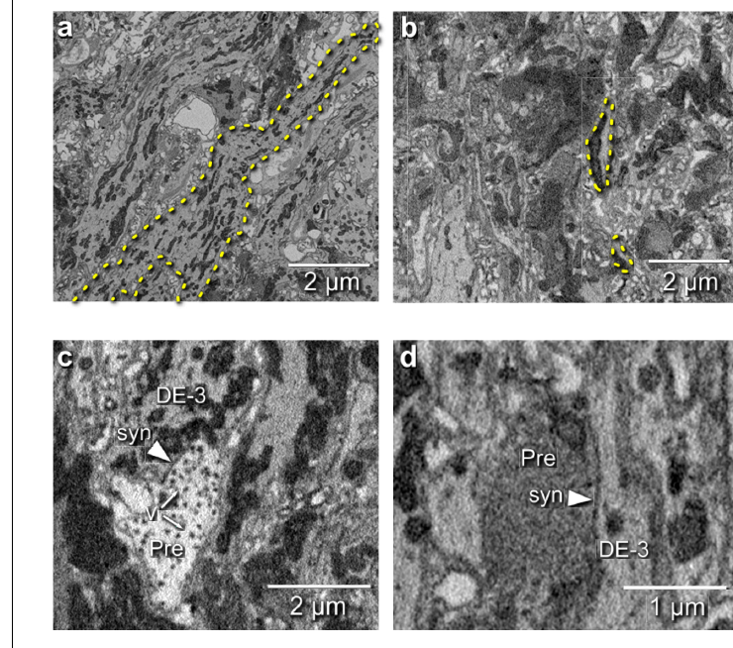
Electron microscopy locates inputs onto a motor neuron
Ashaber and colleagues combined voltage-sensitive imaging with serial blockface electron microscopy in the same leech ganglion. Electron microscopy resolves fine cellular structure using electron-based imaging. The same-tissue design connects functional identity with an anatomical reconstruction rather than comparing unrelated specimens.
They reconstructed the DE-3 motor neuron and identified 531 input synapses. Presynaptic partners could be traced toward their somata, linking contacts to candidate neurons. Distinct terminal appearances were examined, and transmission electron microscopy from another ganglion helped check the interpretation of small vesicles.
Ashaber et al. (2021), Fig. 7(a). Reconstructed DE-3 arbor over a dorsal micro-CT image.
A synapse is a specialized communication site between neurons. Of the 531 input synapses onto DE-3, 44 came from cells in neighboring ganglia, and among partners making at least two contacts the inhibitor DI-1 contributed 52, more than any other identified neuron.
Ashaber et al. (2021), Fig. 6(a–d). Electron-microscopic neurites and synaptic contacts onto DE-3.
Ashaber et al. (2021)
44
Notes:
Teaching transcript:
Ashaber and colleagues combined voltage-sensitive imaging with serial blockface electron microscopy in the same leech ganglion. Electron microscopy resolves fine cellular structure using electron-based imaging. The same-tissue design connects functional identity with an anatomical reconstruction rather than comparing unrelated specimens.
They reconstructed the DE-3 motor neuron and identified 531 input synapses. Presynaptic partners could be traced toward their somata, linking contacts to candidate neurons. Distinct terminal appearances were examined, and transmission electron microscopy from another ganglion helped check the interpretation of small vesicles.
A synapse is a specialized communication site between neurons. Structural contacts establish where anatomical input can reach DE-3, but their appearance alone does not identify transmitter, receptor, sign, or functional strength. Those assignments require physiological or independently established cell information.
Serial blockface imaging repeatedly images and removes a thin surface layer from an embedded sample. The published electron micrographs preserve micrometer scale bars and distinguish an actual contact from a mere crossing of reconstructed processes.
References:
M. Ashaber; Y. Tomina; P. Kassraian; E. A. Bushong; W. B. Kristan Jr; M. H. Ellisman; D. A. Wagenaar (2021). Anatomy and activity patterns in a multifunctional motor neuron and its surrounding circuits. eLife 10:e61881. https://doi.org/10.7554/eLife.61881
Ashaber et al. (2021), Fig. 6(a–d). Electron-microscopic neurites and synaptic contacts onto DE-3.
Figure source: https://doi.org/10.7554/eLife.61881
Ashaber et al. (2021), Fig. 7(a). Reconstructed DE-3 arbor over a dorsal micro-CT image.
Figure source: https://doi.org/10.7554/eLife.61881

Slide 58
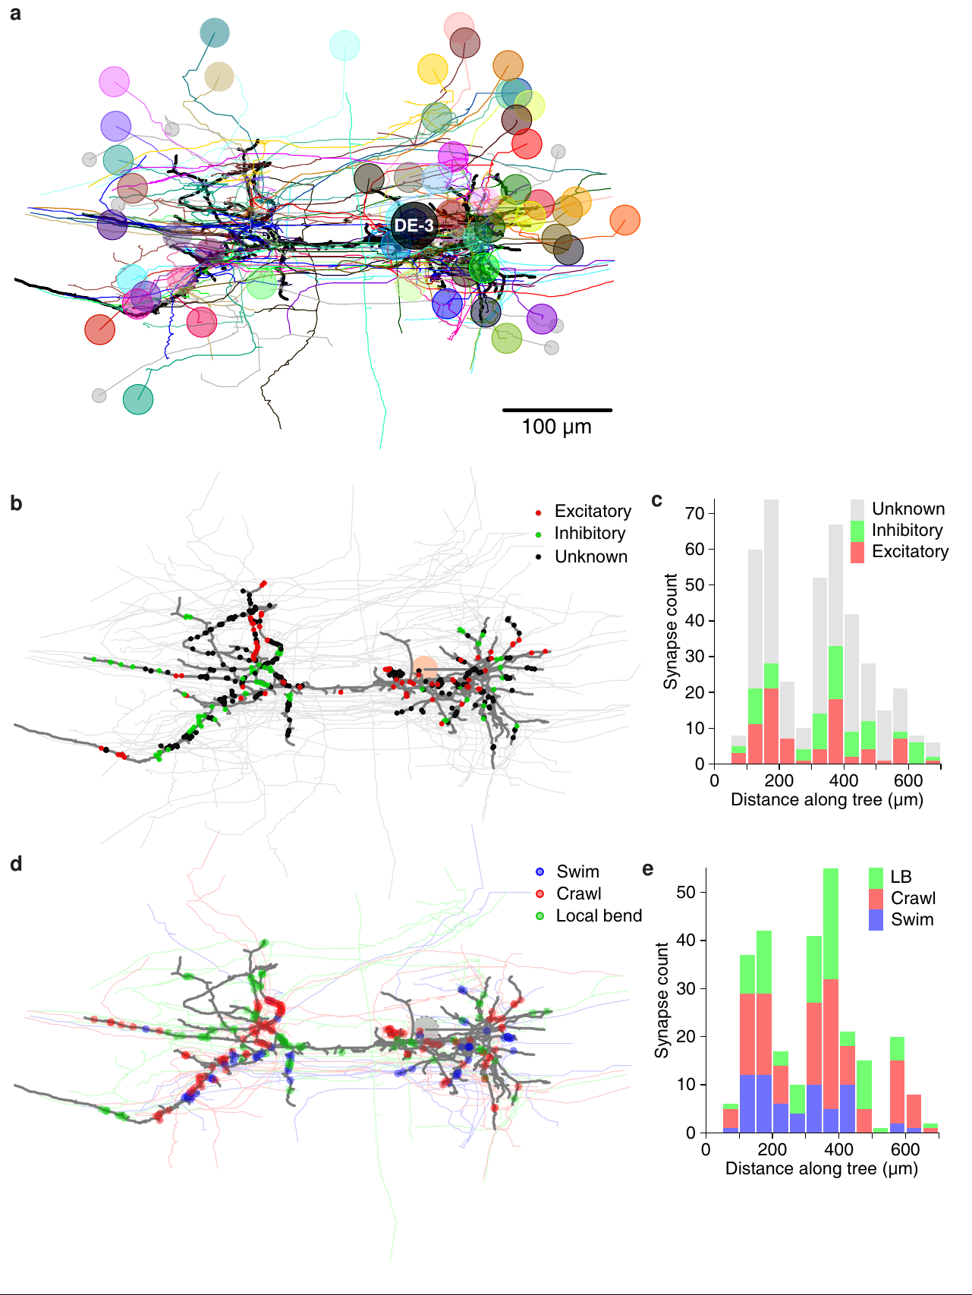
Behavior-specific inputs remain distributed along DE-3
Ashaber and colleagues matched presynaptic neurons in the anatomical reconstruction with their voltage-sensitive activity during fictive swimming and crawling. They then asked whether inputs associated with different behaviors occupied distinct regions of the shared DE-3 arbor. This combines functional participation with measured synapse locations.
Behavior-associated inputs were distributed across the motor neuron rather than segregated into separate large branches for swimming and crawling. Likewise, excitatory and inhibitory input categories did not form the simple large-scale spatial separation expected from a compartmentalized account. The activity and anatomical measurements came from the same ganglion.
A multifunctional motor neuron receives convergent inputs whose active relationships change with behavior. Since most presynaptic partners are themselves multifunctional, Ashaber and colleagues concluded that the premotor network plays the main role in generating distinct motor patterns.
Ashaber et al. (2021), Fig. 10(a–e). Original anatomical distribution of synapses and behavior-associated inputs.
Ashaber et al. (2021)
45
Notes:
Teaching transcript:
Ashaber and colleagues matched presynaptic neurons in the anatomical reconstruction with their voltage-sensitive activity during fictive swimming and crawling. They then asked whether inputs associated with different behaviors occupied distinct regions of the shared DE-3 arbor. This combines functional participation with measured synapse locations.
Behavior-associated inputs were distributed across the motor neuron rather than segregated into separate large branches for swimming and crawling. Likewise, excitatory and inhibitory input categories did not form the simple large-scale spatial separation expected from a compartmentalized account. The activity and anatomical measurements came from the same ganglion.
A multifunctional motor neuron receives convergent inputs whose active relationships change with behavior. Distribution along the arbor does not mean that every synapse has equal effect or that local dendritic interactions are absent. The anatomy constrains spatial explanations while leaving state-dependent synaptic operation and conductance mechanisms for further testing.
The functional association was based on measured activity during the elicited patterns, not a new simulated motor circuit. Anatomical input count is also not identical to physiological synaptic strength, so the two kinds of evidence remain distinct.
References:
M. Ashaber; Y. Tomina; P. Kassraian; E. A. Bushong; W. B. Kristan Jr; M. H. Ellisman; D. A. Wagenaar (2021). Anatomy and activity patterns in a multifunctional motor neuron and its surrounding circuits. eLife 10:e61881. https://doi.org/10.7554/eLife.61881
Ashaber et al. (2021), Fig. 10(a–e). Original anatomical distribution of synapses and behavior-associated inputs.
Figure source: https://doi.org/10.7554/eLife.61881

Slide 59
DE-3 groups synchronized inputs differently for each behavior
Lacking large-scale segregation on DE-3, Ashaber and colleagues identified clusters of neighboring synapses and asked whether each cluster's partners were active at similar phases. Most clusters combined several partners.
Spatial and functional clusters matched for both rhythms, but at different scales. During swimming, synchronized synapses formed clusters extending about 61 to 65 μm along the neurite; during crawling, the best-matching clusters spanned only about 14 to 18 μm. The same synapses group into different assemblies depending on which partners fire together.
Neighboring synapses activated together can sum more effectively than scattered ones, and branches can act as separate integrating compartments. DE-3 can thus read swimming and crawling from one fixed arbor through the pattern of synchrony among its partners, a pattern set by the premotor network.
Ashaber et al. (2021), Fig. 6(a–d). Electron-microscopic neurites and synaptic contacts onto DE-3.
Ashaber et al. (2021)
45a
Notes:
Slides 44 and 45 reconstruct DE-3 and find no large swim or crawl territories on its arbor; the paper's clustering analysis looks for organization at the scale of a few micrometers.
The search moved to small clusters.
The algorithm grouped synapses whose nearest neighbors lay within a set distance and whose overall extent stayed below a set limit, and then asked whether each group's partners shared a phase.
Most groups contained synapses from more than one partner, so clusters combine inputs from different cells.
Behavior changes the scale of synchrony.
The strongest correspondence between spatial and functional clusters occurred at an extent near 61 to 65 micrometers for swim trials and near 14 to 18 micrometers for crawl trials.
Synchronization extended over longer stretches of neurite during swimming than during crawling, within one unchanged anatomy.
Dendritic integration links clusters to output.
Ashaber and colleagues cite work in which branches act as integrative compartments and clustered inputs promote nonlinear integration.
An attractive interpretation in the paper is that clusters are the loci where inputs from synchronized presynaptic assemblies are integrated, the same assemblies whose timing changes at the switch on slide 23.
References:
M. Ashaber; Y. Tomina; P. Kassraian; E. A. Bushong; W. B. Kristan Jr; M. H. Ellisman; D. A. Wagenaar (2021). Anatomy and activity patterns in a multifunctional motor neuron and its surrounding circuits. eLife 10:e61881. https://doi.org/10.7554/eLife.61881

Slide 60
Key takeaways
Central generation. The isolated cord produces a swim-like motor rhythm after brief stimulation, establishing central rhythmic capability without requiring a repeating peripheral stimulus.
Feedback and coordination. Sensory input adjusts phase, burst shape and body-wave timing; central rhythm generation does not make feedback unnecessary for normal locomotion.
Shared neurons, different patterns. Swimming and crawling reorganize overlapping neuronal populations: longitudinal excitors alternate in swimming but cooperate during crawl shortening.
Timing differs from patterning. Drug-induced slow bursting can retain an incorrect circular-muscle phase, so matching period alone does not establish the complete crawl motor program.
Modulation changes circuit state. Serotonin promotes swim expression; dopamine promotes crawling through effects that include rhythm availability, motor-cell phase and altered membrane responsiveness.
Causality depends on preparation. Descending R3b-1 controls coordination in defined whole-cord conditions, while short ganglion chains can coordinate centrally without the brain; anatomical input maps do not alone establish synaptic function.
Kristan & Calabrese (1976); Briggman & Kristan (2006); Crisp et al. (2012); Kearney et al. (2022)
46
Notes:
Central generation. The isolated cord produces a swim-like motor rhythm after brief stimulation, establishing central rhythmic capability without requiring a repeating peripheral stimulus.
Feedback and coordination. Sensory input adjusts phase, burst shape and body-wave timing; central rhythm generation does not make feedback unnecessary for normal locomotion.
Shared neurons, different patterns. Swimming and crawling reorganize overlapping neuronal populations: longitudinal excitors alternate in swimming but cooperate during crawl shortening.
Timing differs from patterning. Drug-induced slow bursting can retain an incorrect circular-muscle phase, so matching period alone does not establish the complete crawl motor program.
Modulation changes circuit state. Serotonin promotes swim expression; dopamine promotes crawling through effects that include rhythm availability, motor-cell phase and altered membrane responsiveness.
Causality depends on preparation. Descending R3b-1 controls coordination in defined whole-cord conditions, while short ganglion chains can coordinate centrally without the brain; anatomical input maps do not alone establish synaptic function.
References:
W. B. Kristan Jr; R. L. Calabrese (1976). Rhythmic swimming activity in neurones of the isolated nerve cord of the leech. Journal of Experimental Biology 65(3):643–668. https://doi.org/10.1242/jeb.65.3.643
X. Yu; B. Nguyen; W. O. Friesen (1999). Sensory feedback can coordinate the swimming activity of the leech. Journal of Neuroscience 19(11):4634–4643. https://doi.org/10.1523/JNEUROSCI.19-11-04634.1999
K. L. Briggman; W. B. Kristan Jr (2006). Imaging dedicated and multifunctional neural circuits generating distinct behaviors. Journal of Neuroscience 26(42):10925–10933. https://doi.org/10.1523/JNEUROSCI.3265-06.2006
J. G. Puhl; K. A. Mesce (2008). Dopamine activates the motor pattern for crawling in the medicinal leech. Journal of Neuroscience 28(16):4192–4200. https://doi.org/10.1523/JNEUROSCI.0136-08.2008
K. M. Crisp; B. R. Gallagher; K. A. Mesce (2012). Mechanisms contributing to the dopamine induction of crawl-like bursting in leech motoneurons. Journal of Experimental Biology 215(17):3028–3036. https://doi.org/10.1242/jeb.069245
J. G. Puhl; M. A. Masino; K. A. Mesce (2012). Necessary, sufficient and permissive: a single locomotor command neuron important for intersegmental coordination. Journal of Neuroscience 32(49):17646–17657. https://doi.org/10.1523/JNEUROSCI.2249-12.2012
M. Ashaber; Y. Tomina; P. Kassraian; E. A. Bushong; W. B. Kristan Jr; M. H. Ellisman; D. A. Wagenaar (2021). Anatomy and activity patterns in a multifunctional motor neuron and its surrounding circuits. eLife 10:e61881. https://doi.org/10.7554/eLife.61881
G. Kearney; M. Radice; A. Sanchez Merlinsky; L. Szczupak (2022). Intersegmental interactions give rise to a global network. Frontiers in Neural Circuits 16:843731. https://doi.org/10.3389/fncir.2022.843731

