Slide 1
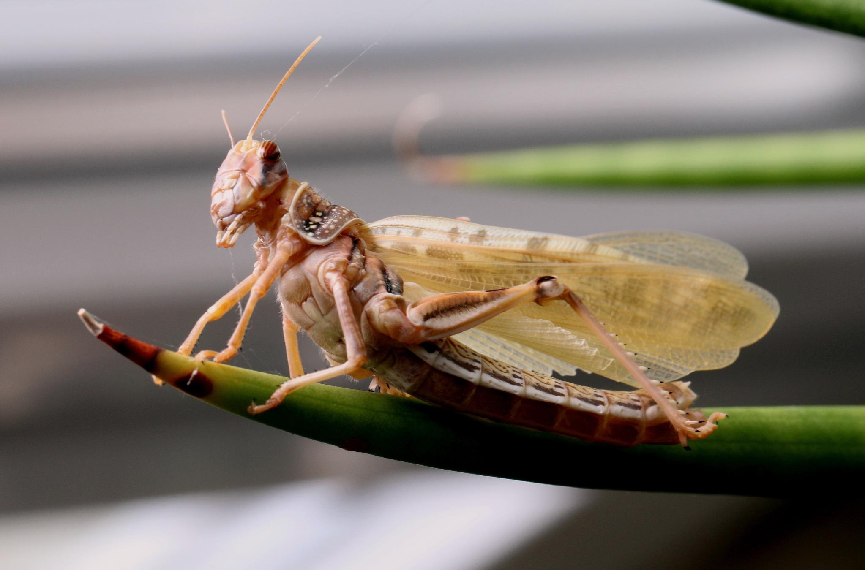
NEUR 411 · NEUROETHOLOGY · FALL 2026
Lecture 8
Locust flight: wind-sensitive interneurons and the flight CPG
Friday, September 11, 2026
Photo: Michael Linnenbach, CC BY-SA 4.0. Desert locust (Schistocerca gregaria), freshly moulted.
Jordan Lopez, Ph.D.
Notes:
Locust flight: wind-sensitive interneurons and the flight CPG
Friday, September 11, 2026
Photo: Michael Linnenbach, CC BY-SA 4.0. Desert locust (Schistocerca gregaria), freshly moulted.
Source: https://commons.wikimedia.org/wiki/File:Schistocerca_gregaria-gehaeutet.jpg

Slide 2
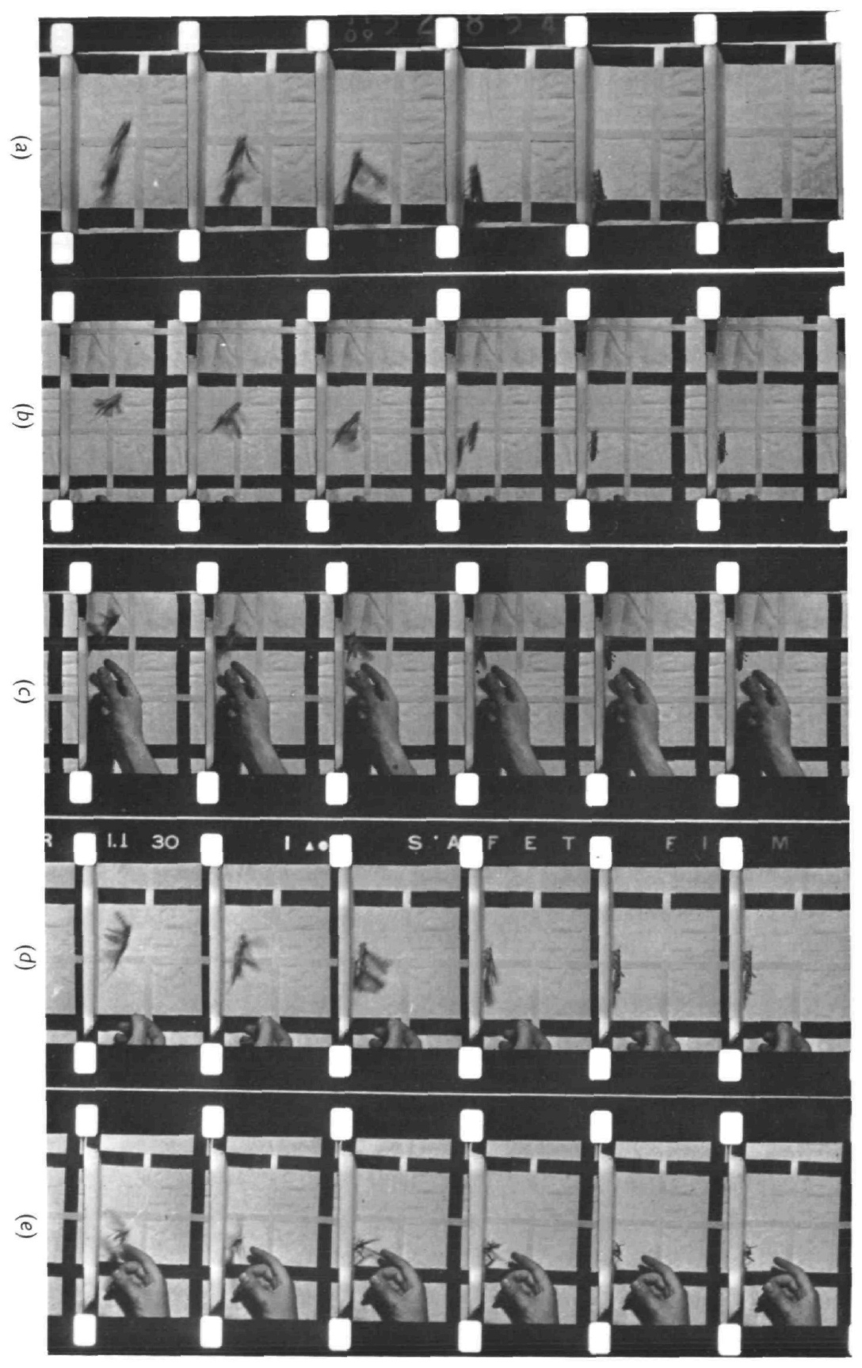
Wind can release flight without initiating every take-off
A locust can begin wing beating when airflow reaches the wind-sensitive hairs on its head. In tethered flight, the animal is held in place, so an experimenter controls airflow independently of the animal’s forward movement. This preparation isolates sensory conditions that can release flight.
Camhi filmed freely jumping Schistocerca gregaria at 64 frames per second and compared wing opening with wind-triggered responses in tethered animals. Wings began opening within approximately 15 ms of jump onset, whereas the fastest measured response to wind took 35 ms.
Wind stimulation is therefore sufficient for flight initiation under tethered conditions but is too slow to explain the initial wing opening in these jumps. A sensory stimulus that can release a behavior need not be the natural trigger on every occasion.
Camhi (1969), Fig. 1 (photographic Plate 1). Filmed take-off sequences of desert locusts.
Camhi (1969c)
02
Notes:
Teaching transcript:
A locust can begin wing beating when airflow reaches the wind-sensitive hairs on its head. In tethered flight, the animal is held in place, so an experimenter controls airflow independently of the animal’s forward movement. This preparation isolates sensory conditions that can release flight.
Camhi filmed freely jumping Schistocerca gregaria at 64 frames per second and compared wing opening with wind-triggered responses in tethered animals. Wings began opening within approximately 15 ms of jump onset, whereas the fastest measured response to wind took 35 ms.
Wind stimulation is therefore sufficient for flight initiation under tethered conditions but is too slow to explain the initial wing opening in these jumps. A sensory stimulus that can release a behavior need not be the natural trigger on every occasion.
The film interval was approximately 15 ms. The comparison concerns the beginning of wing opening, rather than the duration of a complete wing stroke or the time needed to gain altitude.
References:
J. M. Camhi (1969c). Locust wind receptors. III. Contribution to flight initiation and lift control. Journal of Experimental Biology 50(2):363–373. https://doi.org/10.1242/jeb.50.2.363
Camhi (1969), Fig. 1 (photographic Plate 1). Filmed take-off sequences of desert locusts.
Figure source: https://doi.org/10.1242/jeb.50.2.363

Slide 3
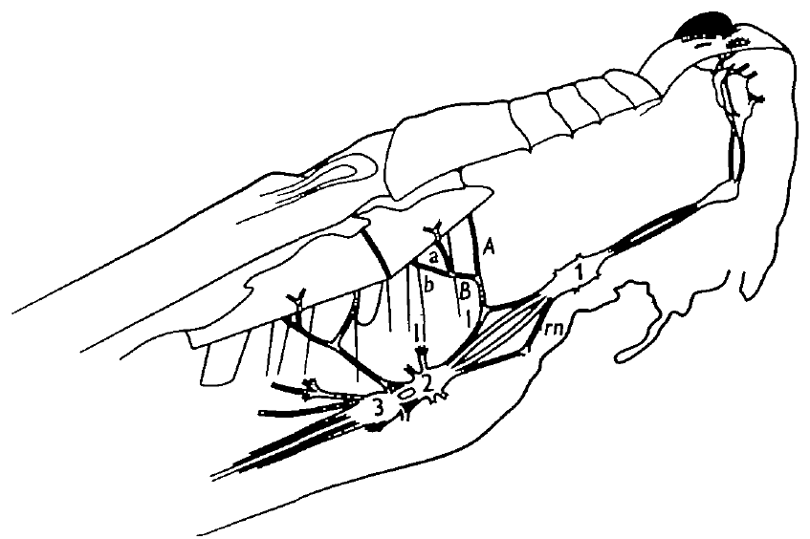
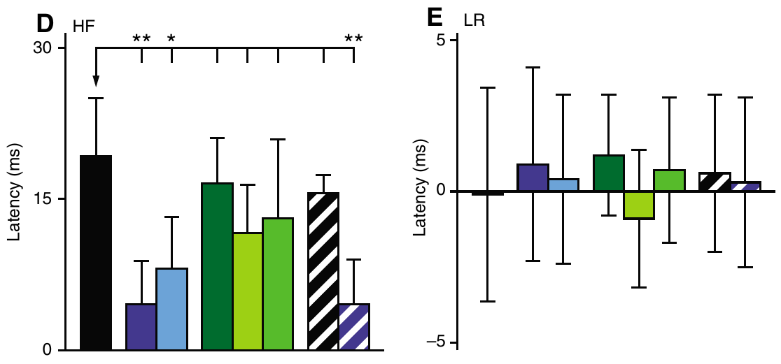
Elevators and depressors alternate with a hindwing lead
Elevator muscles raise the wings; depressor muscles lower them. Forewings attach to the mesothorax and hindwings to the metathorax, the second and third thoracic segments. A motor neuron is a nerve cell whose axon activates a muscle.
Wilson described flight near 17 wingbeats per second, with hindwing activation leading corresponding forewing activation by approximately 6–8 ms. The flight motor score alternated elevators and depressors while coordinating both body sides. The upstroke occupied about 41% of a normal cycle.
Wilson (1961), Fig. 1. Ganglia and muscles of the flight preparation.
These relationships define an organized motor pattern rather than undifferentiated muscle excitation. Later deafferented preparations retained alternation and a hindwing lead, so both features arise within the thoracic circuitry. Left and right homologous muscles also fired nearly synchronously there, preserving the bilateral coordination of the intact motor score.
Buhl et al. (2008), Fig. 2(D,E). Hind–forewing delays and near-synchronous bilateral activity.
Wilson (1961); Buhl et al. (2008)
03
Notes:
Teaching transcript:
Elevator muscles raise the wings; depressor muscles lower them. Forewings attach to the mesothorax and hindwings to the metathorax, the second and third thoracic segments. A motor neuron is a nerve cell whose axon activates a muscle.
Wilson described flight near 17 wingbeats per second, with hindwing activation leading corresponding forewing activation by approximately 6–8 ms. The flight motor score alternated elevators and depressors while coordinating both body sides. The upstroke occupied about 41% of a normal cycle.
These relationships define an organized motor pattern rather than undifferentiated muscle excitation. Later deafferented preparations retained alternation and a hindwing lead, but their measured delays depended on the experimental treatment. Intact movement timing and reduced-preparation muscle timing are related measurements with different mechanical conditions.
A ganglion is a concentration of neuronal cell bodies and interconnected processes. The thoracic ganglia contain flight circuitry; their connectives carry axons between ganglia. The later pharmacology measured muscle activity rather than directly measuring aerodynamic force.
References:
D. M. Wilson (1961). The central nervous control of flight in a locust. Journal of Experimental Biology 38(2):471–490. https://doi.org/10.1242/jeb.38.2.471
E. Buhl; K. Schildberger; P. A. Stevenson (2008). A muscarinic cholinergic mechanism underlies activation of the central pattern generator for locust flight. Journal of Experimental Biology 211(14):2346–2357. https://doi.org/10.1242/jeb.017384
Wilson (1961), Fig. 1. Ganglia and muscles of the flight preparation.
Figure source: https://doi.org/10.1242/jeb.38.2.471
Buhl et al. (2008), Fig. 2(D,E). Hind–forewing delays and near-synchronous bilateral activity.
Figure source: https://doi.org/10.1242/jeb.017384

Slide 4
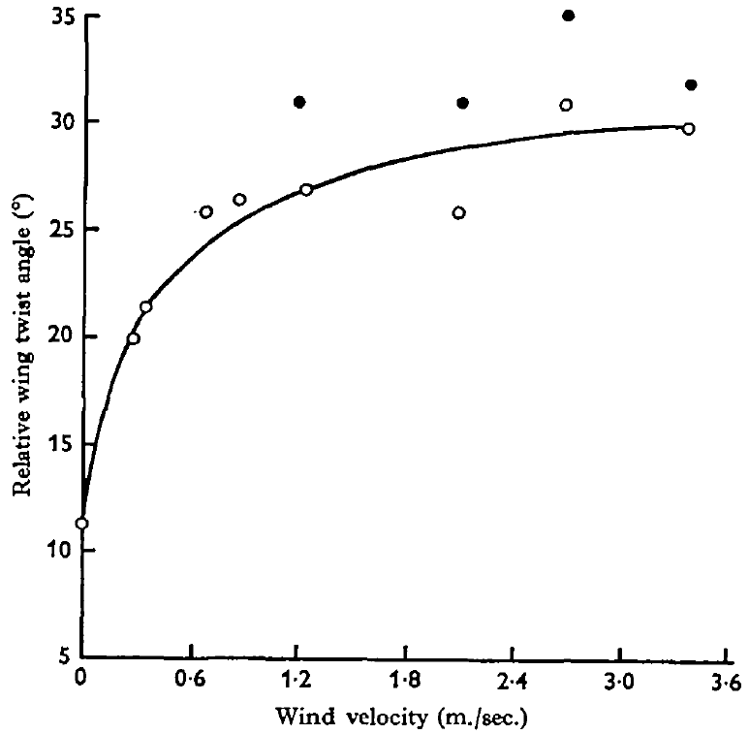
Head airflow changes downstroke wing twist
Pronation is wing rotation toward the orientation used during the downstroke; supination is the reverse rotation associated with the upstroke. Wing twist changes the wing’s interaction with air and therefore contributes to lift control.
Camhi delivered 0–4 m/s airflow to the head of tethered locusts while shielding the body and wings. Stroboscopic photographs measured a paper marker across the forewing chord. Faster head airflow reduced downstroke pronation, whereas upstroke twist changed little.
Directing wind at the wing instead of the head did not reproduce the response. This control supports a sensory-mediated adjustment rather than a direct aerodynamic twisting effect. After a wind acceleration, an added reduction in pronation appeared within about 80 ms, so head receptors adjust each downstroke within a few wingbeats.
Camhi (1969), Fig. 4. Wind speed versus measured forewing twist.
Camhi (1969c)
04
Notes:
Teaching transcript:
Pronation is wing rotation toward the orientation used during the downstroke; supination is the reverse rotation associated with the upstroke. Wing twist changes the wing’s interaction with air and therefore contributes to lift control.
Camhi delivered 0–4 m/s airflow to the head of tethered locusts while shielding the body and wings. Stroboscopic photographs measured a paper marker across the forewing chord. Faster head airflow reduced downstroke pronation, whereas upstroke twist changed little.
Directing wind at the wing instead of the head did not reproduce the response. This control supports a sensory-mediated adjustment rather than a direct aerodynamic twisting effect. The head-wind experiment measured wing angle, so the corresponding change in lift remained a functional interpretation rather than a simultaneous force measurement.
The wing chord runs from its leading edge to its trailing edge. After wind acceleration, the additional reduction in pronation appeared after about 80 ms and relaxed over several hundred milliseconds toward the maintained-speed response.
References:
J. M. Camhi (1969c). Locust wind receptors. III. Contribution to flight initiation and lift control. Journal of Experimental Biology 50(2):363–373. https://doi.org/10.1242/jeb.50.2.363
Camhi (1969), Fig. 4. Wind speed versus measured forewing twist.
Figure source: https://doi.org/10.1242/jeb.50.2.363

Slide 5
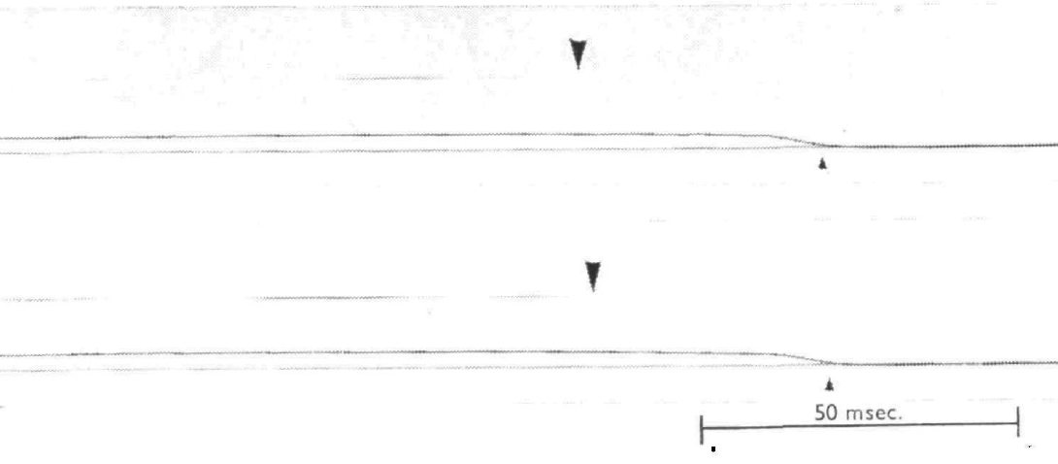
Jump-associated wing opening outruns the wind reflex
Camhi monitored airflow with a hot-wire anemometer and detected wing opening when the forewing stopped interrupting a narrow light beam. Both signals were photographed on the same moving film. This method placed stimulus onset and movement onset on a common time base.
Wind accelerations of 100–600 m/s² ended at speeds of 2.5–4.5 m/s. Typical wing-opening latency was approximately 45 ms, and the shortest measured latency was 35 ms. Freely jumping animals had begun opening their wings within approximately 15 ms.
Covering the head hairs prevented wind-triggered opening; removing the covering restored it. The hairs therefore supplied the tested reflex pathway. Jump-associated wing opening, beginning well before the fastest wind response, depends on a faster initiating route than the hair reflex.
Camhi (1969), Fig. 1. Wind onset and wing-opening latency records.
Camhi (1969c)
05
Notes:
Teaching transcript:
Camhi monitored airflow with a hot-wire anemometer and detected wing opening when the forewing stopped interrupting a narrow light beam. Both signals were photographed on the same moving film. This method placed stimulus onset and movement onset on a common time base.
Wind accelerations of 100–600 m/s² ended at speeds of 2.5–4.5 m/s. Typical wing-opening latency was approximately 45 ms, and the shortest measured latency was 35 ms. Freely jumping animals had begun opening their wings within approximately 15 ms.
Covering the head hairs prevented wind-triggered opening; removing the covering restored it. The hairs therefore supplied the tested reflex pathway. The latency difference supports an additional jump-associated initiating pathway, while the behavioral experiment alone does not identify its neurons.
A latency is the elapsed time between a defined stimulus and a defined response. The common film recording reduced uncertainty from comparing signals recorded by independent clocks. Hair immobilization tested the sensory route rather than merely correlating airflow with movement.
References:
J. M. Camhi (1969c). Locust wind receptors. III. Contribution to flight initiation and lift control. Journal of Experimental Biology 50(2):363–373. https://doi.org/10.1242/jeb.50.2.363
Camhi (1969), Fig. 1. Wind onset and wing-opening latency records.
Figure source: https://doi.org/10.1242/jeb.50.2.363

Slide 6
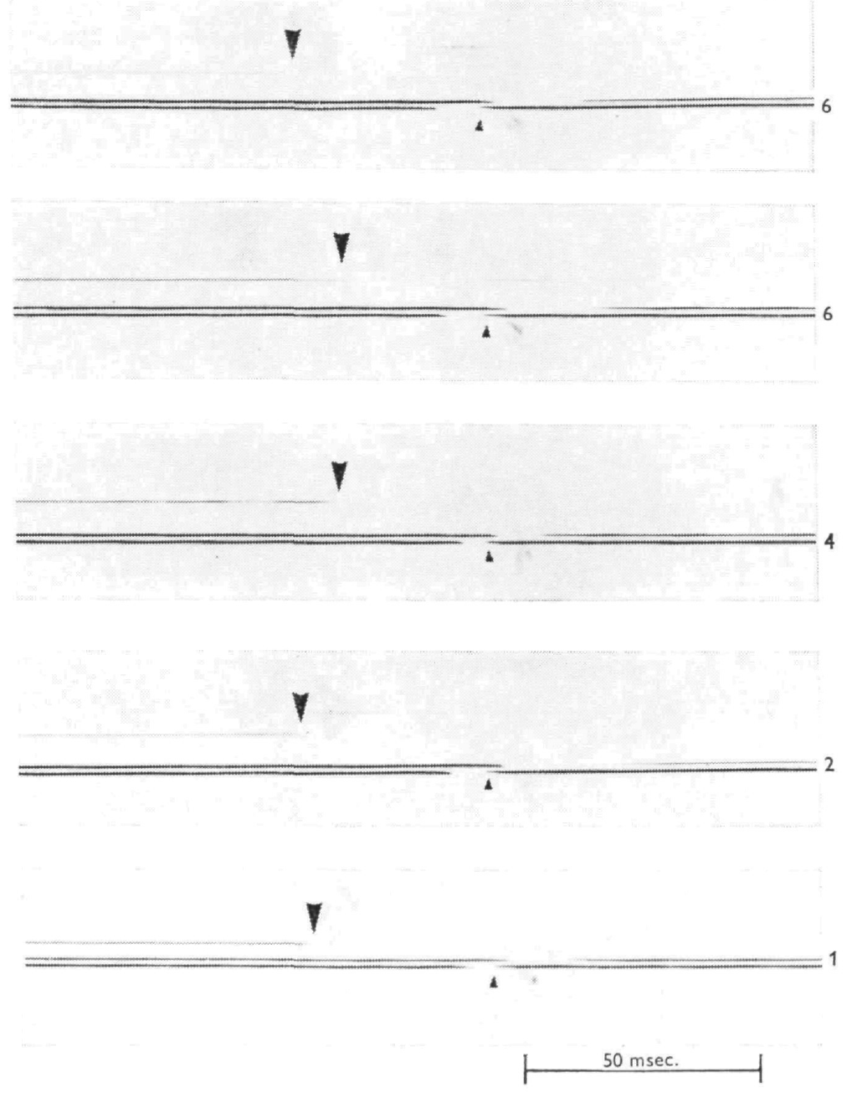
Removing foot contact releases a slower initiation route
The tarsi are the distal portions of the legs that contact a surface. Contact can inhibit flight in a tethered locust. Camhi placed the animal on a hinged roughened rod and lowered the rod to remove support while recording the first wing-opening movement.
Wing opening followed the last possible instant of contact by at least 30 ms. The latency remained similar after successive leg amputations, including trials with only one leg contacting the rod. The support was mechanically independent of the tether, and comparable hand movements did not release flight.
Loss of contact can therefore release flight under these conditions, but its latency is longer than jump-associated wing opening. The controls reduce explanations based on shock to the tether or insufficient initial contact. Similar latencies with one leg or several legs place the delay in the central response.
Camhi (1969), Fig. 2. Tarsal-release and wing-opening records.
Camhi (1969c)
06
Notes:
Teaching transcript:
The tarsi are the distal portions of the legs that contact a surface. Contact can inhibit flight in a tethered locust. Camhi placed the animal on a hinged roughened rod and lowered the rod to remove support while recording the first wing-opening movement.
Wing opening followed the last possible instant of contact by at least 30 ms. The latency remained similar after successive leg amputations, including trials with only one leg contacting the rod. The support was mechanically independent of the tether, and comparable hand movements did not release flight.
Loss of contact can therefore release flight under these conditions, but its latency is longer than jump-associated wing opening. The controls reduce explanations based on shock to the tether or insufficient initial contact. They do not identify the central pathway that couples jumping to flying.
Release from inhibition allows a circuit to become active without necessarily supplying its rhythmic timing. The leg-amputation comparison tested whether distributing contact across several legs had artificially delayed the response.
References:
J. M. Camhi (1969c). Locust wind receptors. III. Contribution to flight initiation and lift control. Journal of Experimental Biology 50(2):363–373. https://doi.org/10.1242/jeb.50.2.363
Camhi (1969), Fig. 2. Tarsal-release and wing-opening records.
Figure source: https://doi.org/10.1242/jeb.50.2.363

Slide 7
Flight starts when net drive crosses threshold
A threshold is the level of excitation a network must reach before it switches from rest to its active state. Inputs that start flight differ in sign: head wind adds excitation, whereas tarsal contact subtracts it, so a locust standing in wind can stay grounded while its feet hold the network below threshold.
Removing contact and adding wind act on the same balance from opposite sides. Release takes away inhibition and frees existing drive operate, while wind supplies new drive; either change can carry the network across threshold, after which the network produces its own rhythm.
The 404 interneurons are a candidate site for this sum. Wind and dimming both raise their tonic firing, and a burst at the kick adds more, so a jump can combine lost contact with central excitation and open the wings sooner than any single tested route.
Camhi (1969), Fig. 2. Tarsal-release and wing-opening records.
Camhi (1969c); Pearson et al. (1985)
06a
Notes:
Slides 2, 5 and 6 compare three ways flight can begin, each with its own latency. Treating them as inputs to one threshold explains why such different stimuli all start the same motor program.
Inputs of opposite sign.
Camhi found that contact under the feet can inhibit flight in a tethered animal, while wind on the head hairs releases it.
An inhibitory input and an excitatory input can be combined on one scale, the net drive reaching the flight circuit.
Release versus drive.
Lowering the rod adds nothing new; it removes a brake, and the flight network can then respond to whatever excitation is already present.
Wind works the other way, by adding excitation until the circuit switches on, and in both cases the rhythm itself comes from the thoracic network.
Where the inputs could meet.
Pearson and colleagues found that 404 neurons fire tonically during flight released by wind or by sudden darkness, and burst at the moment a kick is triggered.
A jump removes ground contact and, if the kick-related burst also occurs, adds central drive at the same time, which could explain why wing opening in free jumps outpaces both the wind reflex and tarsal release.
References:
J. M. Camhi (1969c). Locust wind receptors. III. Contribution to flight initiation and lift control. Journal of Experimental Biology 50(2):363–373. https://doi.org/10.1242/jeb.50.2.363
K. G. Pearson; D. N. Reye; D. W. Parsons; G. Bicker (1985). Flight-initiating interneurons in the locust. Journal of Neurophysiology 53(4):910–925. https://doi.org/10.1152/jn.1985.53.4.910

Slide 8
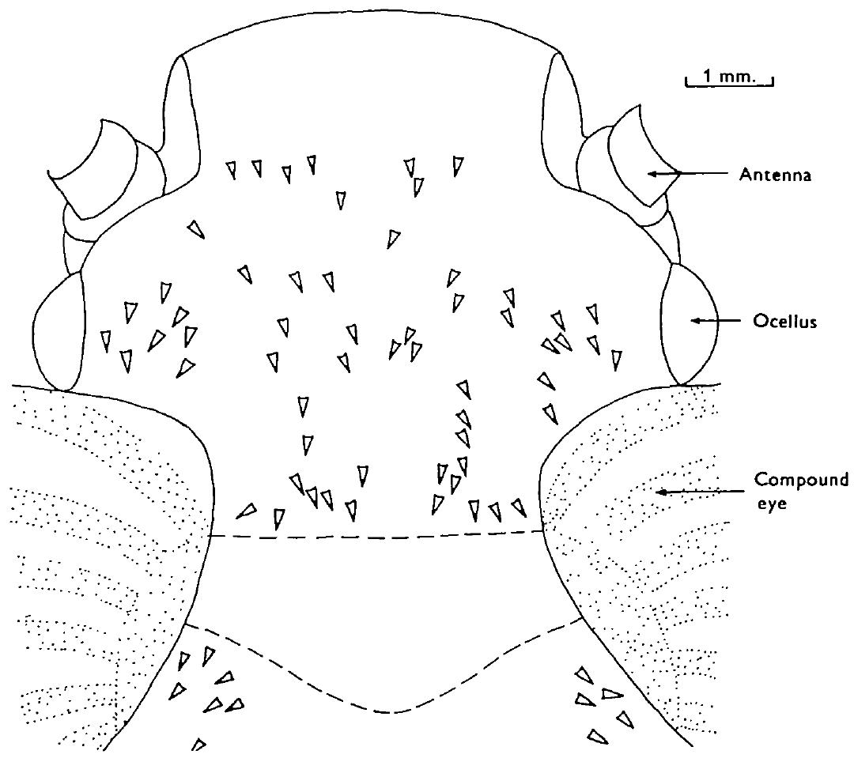
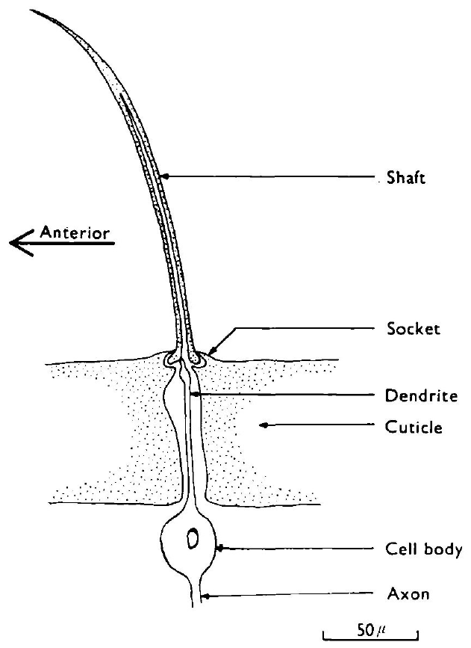
Head hairs form a directional mechanosensory array
A mechanoreceptor converts mechanical displacement into neural activity. The locust’s aerodynamic head hairs are setae, cuticular shafts coupled to sensory cells. Their shafts are approximately 70–250 μm long and curve forward in different directions.
Camhi mapped the curvature of the larger hairs and compared individual hair orientation with sensory responses. A receptor responded most strongly when wind arrived in the plane of its shaft curvature. The array was approximately bilaterally symmetrical and similar across animals.
Different preferred directions allow the head to distribute airflow information across receptors. A single receptor’s firing rate still depends on both wind direction and speed, so it is not an unambiguous speed meter. Similar maps across animals mean that a given hair position reports a similar wind angle in every locust.
Camhi (1969), Fig. 1. Published anatomy of a seta and its sensory neuron.
Camhi (1969), Fig. 7. Map of head-hair curvature and preferred wind directions.
Camhi (1969a)
07
Notes:
Teaching transcript:
A mechanoreceptor converts mechanical displacement into neural activity. The locust’s aerodynamic head hairs are setae, cuticular shafts coupled to sensory cells. Their shafts are approximately 70–250 μm long and curve forward in different directions.
Camhi mapped the curvature of the larger hairs and compared individual hair orientation with sensory responses. A receptor responded most strongly when wind arrived in the plane of its shaft curvature. The array was approximately bilaterally symmetrical and similar across animals.
Different preferred directions allow the head to distribute airflow information across receptors. A single receptor’s firing rate still depends on both wind direction and speed, so it is not an unambiguous speed meter. The anatomical map predicts preferred direction but does not measure the full response of every smaller hair.
A sensillum is a sensory structure that includes its cuticular specialization and associated sensory neuron. The receptor dendrite attaches eccentrically near the shaft base; the shaft pivots in a socket instead of bending freely along its length.
References:
J. M. Camhi (1969a). Locust wind receptors. I. Transducer mechanics and sensory response. Journal of Experimental Biology 50(2):335–348. https://doi.org/10.1242/jeb.50.2.335
Camhi (1969), Fig. 7. Map of head-hair curvature and preferred wind directions.
Figure source: https://doi.org/10.1242/jeb.50.2.335
Camhi (1969), Fig. 1. Published anatomy of a seta and its sensory neuron.
Figure source: https://doi.org/10.1242/jeb.50.2.335

Slide 9
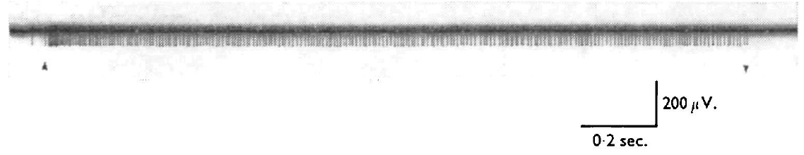
Sustained wind produces adapting sensory discharge
Adaptation is a decline in a receptor’s response during a maintained stimulus. Camhi teased small axon bundles from the circumoesophageal connective and recorded a sensory unit during controlled airflow. These connectives run beside the oesophagus between head ganglia.
A 4.5 m/s wind directed approximately 10° left of center produced an initial discharge near 200 spikes/s. Within about half a second, the rate declined to a maintained level near 125 spikes/s. Continued airflow produced a further modest decline over minutes.
Camhi (1969), Fig. 2. Sensory spikes during airflow onset and cessation.
The sensory discharge contains both an onset response and information about continuing airflow. A receptor still firing near 125 spikes/s after adapting keeps reporting head wind for as long as the airflow lasts, which in a flying locust means throughout the flight.
Camhi (1969), Fig. 1. Seta shaft, socket and attached sensory cell.
Camhi (1969a)
08
Notes:
Teaching transcript:
Adaptation is a decline in a receptor’s response during a maintained stimulus. Camhi teased small axon bundles from the circumoesophageal connective and recorded a sensory unit during controlled airflow. These connectives run beside the oesophagus between head ganglia.
A 4.5 m/s wind directed approximately 10° left of center produced an initial discharge near 200 spikes/s. Within about half a second, the rate declined to a maintained level near 125 spikes/s. Continued airflow produced a further modest decline over minutes.
The sensory discharge contains both an onset response and information about continuing airflow. Adaptation does not imply complete loss of sensitivity. Because these recordings were extracellular, they establish action-potential timing but do not directly measure the receptor current or identify its mechanically gated ion channel.
An action potential is a brief propagated electrical impulse. Extracellular recording detects the voltage associated with that impulse outside the cell, whereas intracellular recording can resolve the cell’s membrane potential.
References:
J. M. Camhi (1969a). Locust wind receptors. I. Transducer mechanics and sensory response. Journal of Experimental Biology 50(2):335–348. https://doi.org/10.1242/jeb.50.2.335
Camhi (1969), Fig. 2. Sensory spikes during airflow onset and cessation.
Figure source: https://doi.org/10.1242/jeb.50.2.335
Camhi (1969), Fig. 1. Seta shaft, socket and attached sensory cell.
Figure source: https://doi.org/10.1242/jeb.50.2.335

Slide 10
Socket pivot converts wind into receptor spikes
Mechanotransduction is the conversion of a mechanical force into an electrical signal. Wind pushes the curved shaft, the shaft pivots in its socket, and its base moves the dendrite attached off-center near the pivot. That movement deforms the dendritic membrane and opens mechanically gated ion channels.
Cations flowing through those channels depolarize the dendrite, producing a receptor potential graded with deflection. Once that potential passes spike threshold, the axon fires at a rate that rises with depolarization, so larger deflections give higher spike rates.
Camhi (1969), Fig. 2. Sensory spikes during airflow onset and cessation.
Adaptation then reshapes the rate over time. The fast decline in the first half-second leaves a strong onset burst followed by a lower maintained rate, so one receptor feeds two kinds of interneuron: sustained wind-indicator cells read the maintained rate, and acceleration cells respond most to rapid onset.
Camhi (1969), Fig. 1. Seta shaft, socket and attached sensory cell.
Camhi (1969a); Camhi (1969b)
08a
Notes:
Slides 7 to 10 describe the hair, its socket and its spike output without walking through the steps that link wind to spikes. Those steps are general features of insect mechanoreceptors applied to this hair.
From airflow to membrane.
The shaft does not bend along its length; it rotates at the socket, so the base acts like a lever on the eccentric dendrite.
Deforming the dendrite membrane opens channels that respond to mechanical force, the first electrical event in the pathway.
From membrane to spikes.
The inward current makes a graded depolarization, and the spike-initiating zone converts it into a spike rate.
Camhi’s maximum rate near 200 spikes per second at onset therefore reflects both a large deflection and a fresh, unadapted receptor.
Two signals from one receptor.
The onset burst and the maintained rate carry different information, and Camhi’s interneuron classes appear to emphasize one or the other.
Wind-indicator cells kept firing in steady wind, while acceleration cells were strongly driven only by fast increases in airflow.
References:
J. M. Camhi (1969a). Locust wind receptors. I. Transducer mechanics and sensory response. Journal of Experimental Biology 50(2):335–348. https://doi.org/10.1242/jeb.50.2.335
J. M. Camhi (1969b). Locust wind receptors. II. Interneurones in the cervical connective. Journal of Experimental Biology 50(2):349–362. https://doi.org/10.1242/jeb.50.2.349

Slide 11
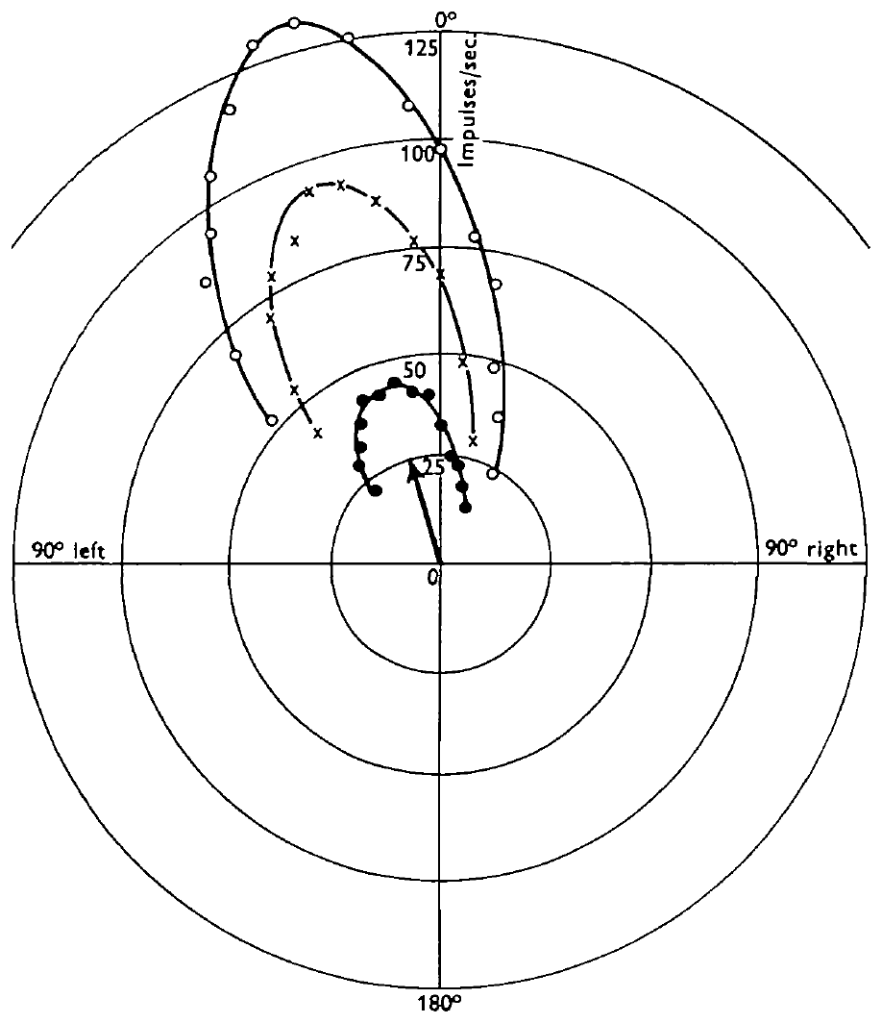
One hair encodes direction and speed together
Camhi rotated a calibrated wind jet around the head and recorded the maintained firing of a single sensory axon. A directional tuning curve relates neural response to stimulus direction. Different wind speeds were tested with the same receptor.
The published curves used 1.5, 3.0 and 4.5 m/s wind. Maximum firing occurred near 15° left of center, close to the hair’s measured curvature plane. The angular separation between the half-maximum responses was approximately 54°, and higher speeds produced higher firing rates.
The rate therefore combines direction and speed rather than representing either variable alone. The alignment of response and shaft curvature links anatomy to sensory tuning. Faster wind raised firing at every angle, so speed scales the whole tuning curve while the hair’s curvature fixes where its peak lies.
Camhi (1969), Fig. 7. Hair orientations distributed across the head.
Camhi (1969), Fig. 3. Directional response curves at three wind speeds.
Camhi (1969a)
09
Notes:
Teaching transcript:
Camhi rotated a calibrated wind jet around the head and recorded the maintained firing of a single sensory axon. A directional tuning curve relates neural response to stimulus direction. Different wind speeds were tested with the same receptor.
The published curves used 1.5, 3.0 and 4.5 m/s wind. Maximum firing occurred near 15° left of center, close to the hair’s measured curvature plane. The angular separation between the half-maximum responses was approximately 54°, and higher speeds produced higher firing rates.
The rate therefore combines direction and speed rather than representing either variable alone. The alignment of response and shaft curvature links anatomy to sensory tuning. These measurements do not establish the decoding operation performed by downstream interneurons or behaviorally achievable angular precision.
Half-maximum width describes the breadth of a response curve. It is not the smallest direction difference that the intact animal can detect. Comparing the same cell at several speeds separates changing stimulus strength from differences among receptors.
References:
J. M. Camhi (1969a). Locust wind receptors. I. Transducer mechanics and sensory response. Journal of Experimental Biology 50(2):335–348. https://doi.org/10.1242/jeb.50.2.335
Camhi (1969), Fig. 3. Directional response curves at three wind speeds.
Figure source: https://doi.org/10.1242/jeb.50.2.335
Camhi (1969), Fig. 7. Hair orientations distributed across the head.
Figure source: https://doi.org/10.1242/jeb.50.2.335

Slide 12
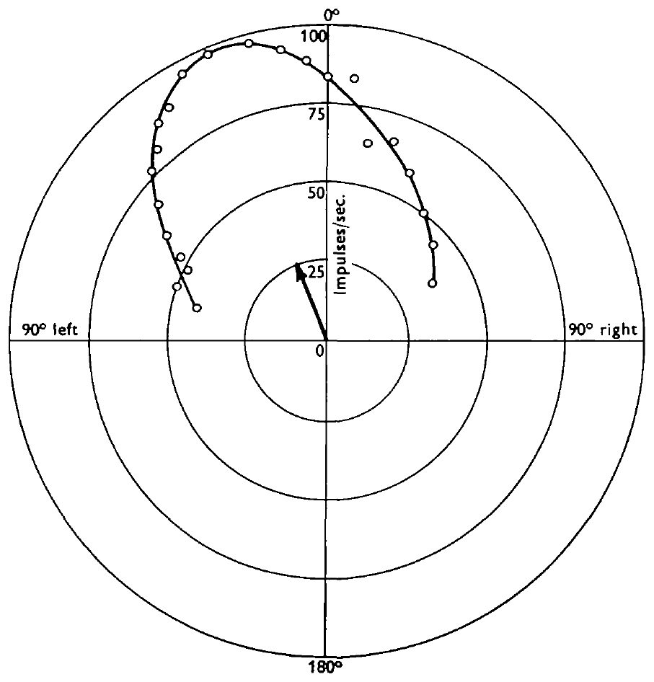
Several mechanical asymmetries sharpen hair tuning
Camhi separated three potential sources of directional tuning: shaft curvature, socket elasticity, and the off-center attachment of the receptor dendrite. Mechanical displacement with a pipette controlled the shaft movement directly, reducing the contribution of aerodynamic drag.
A 50 μm shaft deflection produced a broader directional response than wind stimulation. Its typical half-maximum width was approximately 85°, compared with approximately 54° for the wind response. Measurements of socket resistance and drag on remounted shafts were broader still.
No tested component alone accounted for the narrow wind-tuning curve. The results support combined contributions from mechanical structure and sensory coupling. Each asymmetry favors displacement in one plane, so their effects add, and the intact hair ends up more selective than any single mechanism makes it.
Camhi (1969), Fig. 1. The shaft, socket and eccentric dendritic attachment.
Camhi (1969), Fig. 4. Directional responses to imposed 50 μm hair deflections.
Camhi (1969a)
10
Notes:
Teaching transcript:
Camhi separated three potential sources of directional tuning: shaft curvature, socket elasticity, and the off-center attachment of the receptor dendrite. Mechanical displacement with a pipette controlled the shaft movement directly, reducing the contribution of aerodynamic drag.
A 50 μm shaft deflection produced a broader directional response than wind stimulation. Its typical half-maximum width was approximately 85°, compared with approximately 54° for the wind response. Measurements of socket resistance and drag on remounted shafts were broader still.
No tested component alone accounted for the narrow wind-tuning curve. The results support combined contributions from mechanical structure and sensory coupling. They do not identify the molecular transduction channel, and the remounted-shaft experiment depended on the mechanical properties of the replacement socket.
The original hair socket resists displacement differently in different directions. Camhi tested excised shafts in a non-directional mounting to separate shaft aerodynamics from socket resistance. The combined explanation concerns peripheral mechanics, not a newly established central computation.
References:
J. M. Camhi (1969a). Locust wind receptors. I. Transducer mechanics and sensory response. Journal of Experimental Biology 50(2):335–348. https://doi.org/10.1242/jeb.50.2.335
Camhi (1969), Fig. 4. Directional responses to imposed 50 μm hair deflections.
Figure source: https://doi.org/10.1242/jeb.50.2.335
Camhi (1969), Fig. 1. The shaft, socket and eccentric dendritic attachment.
Figure source: https://doi.org/10.1242/jeb.50.2.335

Slide 13
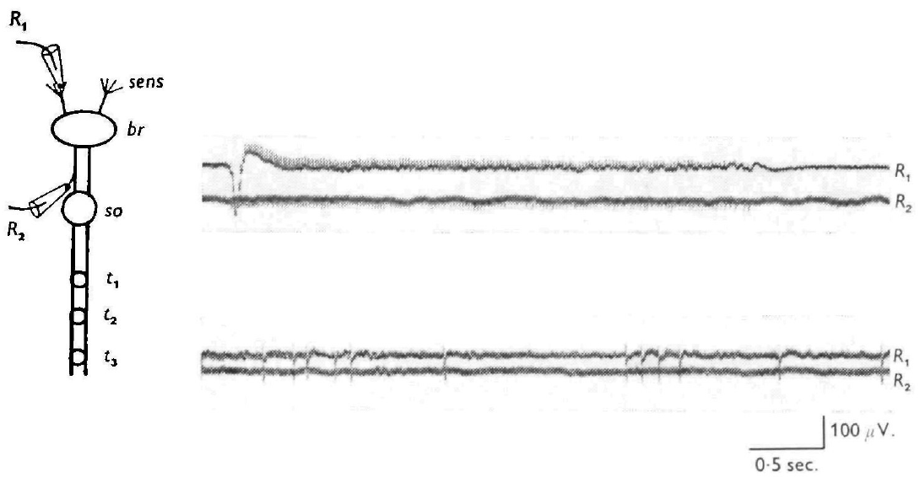
Head-hair axons reach the suboesophageal ganglion
Camhi recorded simultaneously from a cut hair tip and an axon in the ipsilateral circumoesophageal connective. Ipsilateral means on the same side; contralateral means on the opposite side. Every recorded sensory impulse appeared at both sites.
The two recordings were separated by approximately 10 ms. Electrical stimulation of the connective evoked impulses that traveled back toward the hair, with latencies of 7–14 ms and an estimated conduction speed near 0.5 m/s. Stimulation farther back in the cervical connective did not evoke the same sensory response.
These tests support axons passing through the brain and terminating before the thoracic pathway, probably in the suboesophageal ganglion. Wind information therefore reaches thoracic flight circuits only after a synaptic relay to interneurons that descend in the cervical connective.
Camhi (1969), Fig. 8. Simultaneous seta and connective recordings.
Camhi (1969a)
11
Notes:
Teaching transcript:
Camhi recorded simultaneously from a cut hair tip and an axon in the ipsilateral circumoesophageal connective. Ipsilateral means on the same side; contralateral means on the opposite side. Every recorded sensory impulse appeared at both sites.
The two recordings were separated by approximately 10 ms. Electrical stimulation of the connective evoked impulses that traveled back toward the hair, with latencies of 7–14 ms and an estimated conduction speed near 0.5 m/s. Stimulation farther back in the cervical connective did not evoke the same sensory response.
These tests support axons passing through the brain and terminating before the thoracic pathway, probably in the suboesophageal ganglion. The physiological inference is stronger than visual proximity alone. It does not reconstruct every terminal branch or directly identify each sensory-to-interneuron synapse.
Antidromic conduction is propagation toward the cell’s peripheral origin, opposite to the usual direction of sensory information flow. The small sensory axons differ from the later giant interneuron, which conveys descending information much faster.
References:
J. M. Camhi (1969a). Locust wind receptors. I. Transducer mechanics and sensory response. Journal of Experimental Biology 50(2):335–348. https://doi.org/10.1242/jeb.50.2.335
Camhi (1969), Fig. 8. Simultaneous seta and connective recordings.
Figure source: https://doi.org/10.1242/jeb.50.2.335

Slide 14
Axon diameter sets how fast wind news travels
Conduction velocity is the speed at which an action potential travels along an axon. Each spike spreads current ahead of itself to depolarize the adjacent stretch of membrane; a wider axon has lower internal resistance, so current spreads farther and the spike advances faster.
The thin hair axons conduct near 0.5 m/s, and the trip from hair to connective takes about 10 ms. Part of the minimum 35 ms wind-reflex latency is therefore spent on travel in slow sensory fibers before any central relay begins.
Descending interneurons recover that time. The TCG axon is about 20 μm wide, and its stimulation evoked fictive flight after as little as 23 ms, so a wide axon carrying wind information to the thorax shortens the path from head to flight motor output.
Camhi (1969), Fig. 8. Simultaneous seta and connective recordings.
Camhi (1969a); Camhi (1969c); Buhl et al. (2008)
11a
Notes:
Slide 11 measures how slowly the hair axons conduct. Placing that number beside the reflex latency on slide 5 and the TCG result on slide 33 explains why a fast descending pathway matters.
Why size changes speed.
Current entering at an active patch of membrane flows along the inside of the axon, and a larger diameter offers that current less resistance.
More current reaches the membrane ahead, which reaches threshold sooner, so the spike moves forward faster.
A latency budget.
Camhi’s simultaneous recordings place about ten milliseconds between the hair tip and the connective electrode.
That delay occurs before the signal reaches any interneuron, and it is part of the overall wind-reflex delay measured on slide 5.
A fast route to the thorax.
Buhl and colleagues stimulated the large TCG axon and recorded flight onset after roughly two dozen milliseconds.
A thick descending axon moves wind information over the long distance from the head to the thoracic ganglia with little delay, so most of the remaining time is spent in central processing.
References:
J. M. Camhi (1969a). Locust wind receptors. I. Transducer mechanics and sensory response. Journal of Experimental Biology 50(2):335–348. https://doi.org/10.1242/jeb.50.2.335
J. M. Camhi (1969c). Locust wind receptors. III. Contribution to flight initiation and lift control. Journal of Experimental Biology 50(2):363–373. https://doi.org/10.1242/jeb.50.2.363
E. Buhl; K. Schildberger; P. A. Stevenson (2008). A muscarinic cholinergic mechanism underlies activation of the central pattern generator for locust flight. Journal of Experimental Biology 211(14):2346–2357. https://doi.org/10.1242/jeb.017384

Slide 15
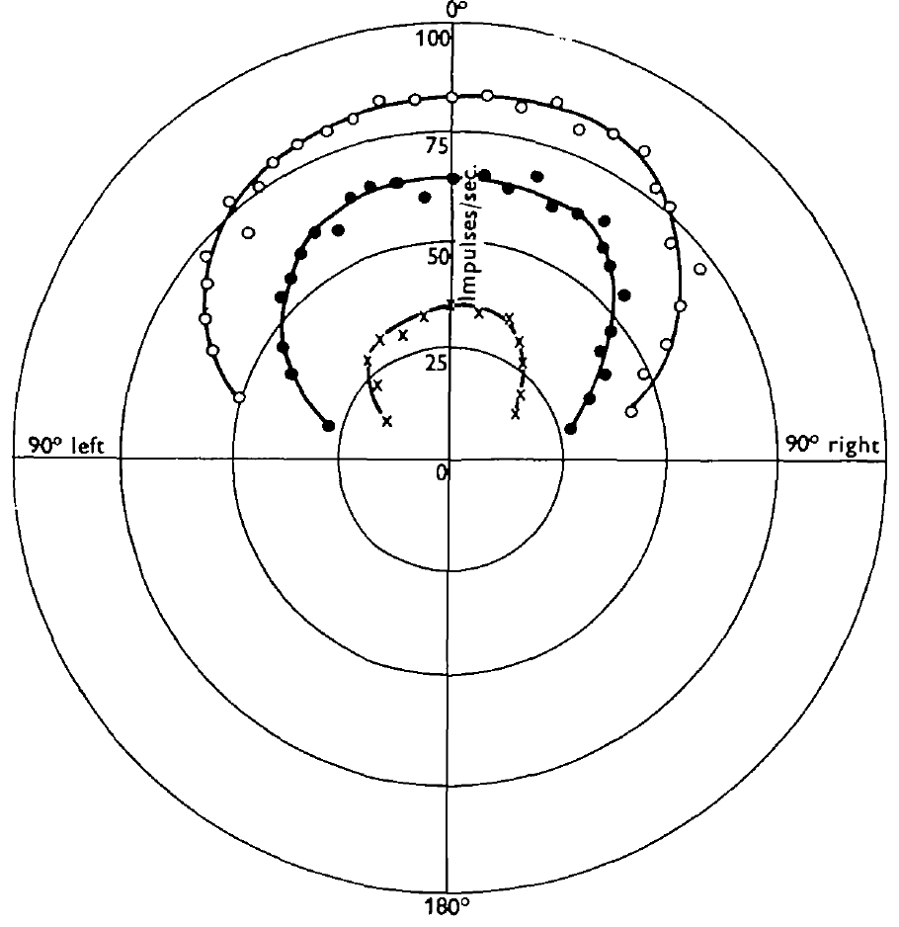
Wind-indicator interneurons pool broad directional input
An interneuron connects other neurons rather than directly serving as the primary receptor or muscle output. Camhi recorded individual wind-responsive units in the cervical connective, downstream of the head sensory pathways. Wind-indicator cells sustained discharge during maintained airflow.
Their directional half-maximum width was approximately 140°, substantially broader than individual sensory receptors. At favorable direction, a 4.5 m/s wind produced a maintained rate near 85 spikes/s. Small air jets mapped inputs from head hairs on both sides with varied preferred directions.
Pooling differently tuned receptors is consistent with a broad signal for the presence and intensity of airflow. Single-hair deflection rarely evoked interneuron spikes, while stimulating separate hair groups together preserved or increased the response, so each cell sums excitation from many receptors.
Camhi (1969), Fig. 7. Bilateral distribution of directional sensory hairs.
Camhi (1969), Fig. 2. Broad wind-indicator tuning at several speeds.
Camhi (1969b); Camhi (1969a)
12
Notes:
Teaching transcript:
An interneuron connects other neurons rather than directly serving as the primary receptor or muscle output. Camhi recorded individual wind-responsive units in the cervical connective, downstream of the head sensory pathways. Wind-indicator cells sustained discharge during maintained airflow.
Their directional half-maximum width was approximately 140°, substantially broader than individual sensory receptors. At favorable direction, a 4.5 m/s wind produced a maintained rate near 85 spikes/s. Small air jets mapped inputs from head hairs on both sides with varied preferred directions.
Pooling differently tuned receptors is consistent with a broad signal for the presence and intensity of airflow. The recordings and receptive-field tests do not directly establish the exact synaptic weights. Camhi’s classification described response properties rather than assigning each unit a modern identified-cell label.
Single-hair deflection did not reliably evoke interneuron spikes. Simultaneous stimulation of separate hair groups increased or preserved the response, supporting convergence of excitatory sensory influences.
References:
J. M. Camhi (1969b). Locust wind receptors. II. Interneurones in the cervical connective. Journal of Experimental Biology 50(2):349–362. https://doi.org/10.1242/jeb.50.2.349
J. M. Camhi (1969a). Locust wind receptors. I. Transducer mechanics and sensory response. Journal of Experimental Biology 50(2):335–348. https://doi.org/10.1242/jeb.50.2.335
Camhi (1969), Fig. 2. Broad wind-indicator tuning at several speeds.
Figure source: https://doi.org/10.1242/jeb.50.2.349
Camhi (1969), Fig. 7. Bilateral distribution of directional sensory hairs.
Figure source: https://doi.org/10.1242/jeb.50.2.335

Slide 16
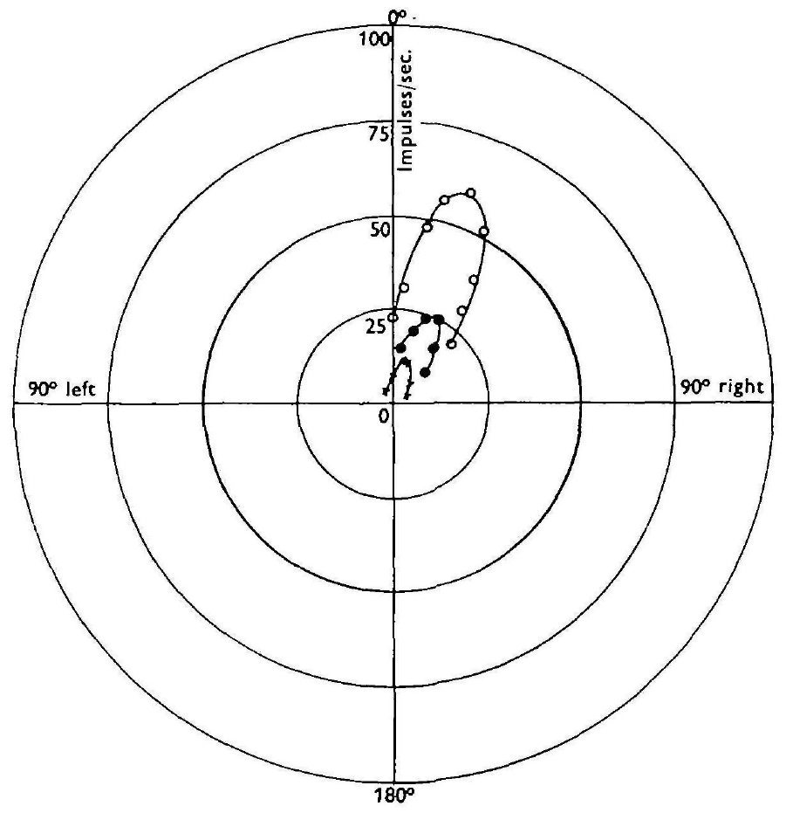
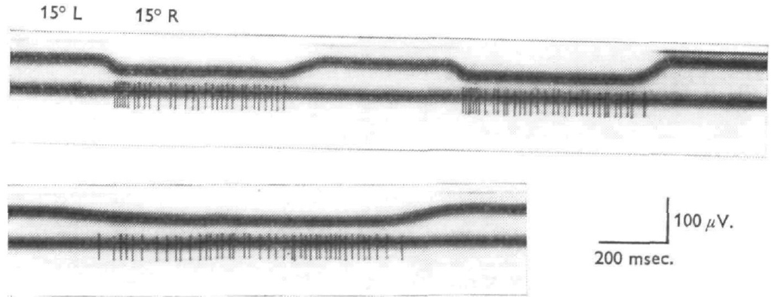
Wind-direction cells retain sharper angular preferences
Camhi distinguished wind-direction cells from broadly tuned wind-indicator cells by varying wind angle, speed and angular motion. The recorded units maintained firing in wind but had sharper angular selectivity. Their mapped sensory inputs had more similar preferred directions.
Directional half-maximum widths were approximately 60°. Rotating an already flowing jet toward a cell’s favorable direction could add a transient burst, whereas moving away could briefly reduce discharge. The rate-speed relationship was not simply linear across the tested range.
A downstream cell can therefore emphasize directional information while remaining sensitive to stimulus strength and change. The extra burst when wind swings toward the preferred side suits a signal for yaw, the rotation about the vertical axis that changes head-wind angle in flight.
Camhi (1969), Fig. 4. Spike responses to pivots of a maintained wind jet.
Camhi (1969), Fig. 3. Wind-direction tuning at several airflow speeds.
Camhi (1969b)
13
Notes:
Teaching transcript:
Camhi distinguished wind-direction cells from broadly tuned wind-indicator cells by varying wind angle, speed and angular motion. The recorded units maintained firing in wind but had sharper angular selectivity. Their mapped sensory inputs had more similar preferred directions.
Directional half-maximum widths were approximately 60°. Rotating an already flowing jet toward a cell’s favorable direction could add a transient burst, whereas moving away could briefly reduce discharge. The rate-speed relationship was not simply linear across the tested range.
A downstream cell can therefore emphasize directional information while remaining sensitive to stimulus strength and change. These findings support a possible role in directional stabilization, but Camhi did not prove that a particular recorded unit was necessary for a specific yaw-correction movement.
Yaw is rotation around the animal’s vertical axis. A head-wind angle can change during yaw or changes in the local airstream, so neural direction sensitivity must be interpreted with the mechanical context.
References:
J. M. Camhi (1969b). Locust wind receptors. II. Interneurones in the cervical connective. Journal of Experimental Biology 50(2):349–362. https://doi.org/10.1242/jeb.50.2.349
Camhi (1969), Fig. 3. Wind-direction tuning at several airflow speeds.
Figure source: https://doi.org/10.1242/jeb.50.2.349
Camhi (1969), Fig. 4. Spike responses to pivots of a maintained wind jet.
Figure source: https://doi.org/10.1242/jeb.50.2.349

Slide 17
Input mix sets each interneuron’s tuning width
The tuning of a convergent interneuron, one that sums input from many receptors, depends on which receptors it collects. If its hairs prefer widely different directions, wind from almost any angle excites some of them, and the summed response stays high across a wide range of angles.
Wind-indicator cells reach about 140° this way, far wider than the roughly 54° of one hair. Wind-direction cells draw on hairs whose preferences cluster, so their summed response falls off almost as steeply as a single hair’s, near 60°.
The two designs trade one variable for another. A broad cell gives up angle but gains a reliable report that wind is present at a given strength, which suits keeping flight going. A narrow cell keeps the angle information needed to detect drift away from head-on airflow.
Camhi (1969), Fig. 4. Spike responses to pivots of a maintained wind jet.
Camhi (1969), Fig. 3. Wind-direction tuning at several airflow speeds.
Camhi (1969a); Camhi (1969b)
13a
Notes:
Slides 9, 12 and 13 report three tuning widths for the hair, the wind-indicator cell and the wind-direction cell. The width of an interneuron follows from how its inputs are arranged.
Summing different preferences.
When the inputs point in many directions, some are always well driven, so the total changes little as wind angle changes.
Small air jets aimed at separate hair groups revealed that a single broadly tuned cell collects from receptors on the left and right of the head pointing in many directions.
Summing similar preferences.
When the inputs share a preferred direction, they rise and fall together as the angle changes, and the sum keeps their sharpness.
Camhi’s mapping of wind-direction cells found inputs with more similar preferred directions, matching their narrower curves.
What each code is good for.
Broad pooling sacrifices angle to provide a steady intensity signal that changes little when the head turns.
Narrow tuning keeps the angle signal that a corrective steering response would need.
References:
J. M. Camhi (1969a). Locust wind receptors. I. Transducer mechanics and sensory response. Journal of Experimental Biology 50(2):335–348. https://doi.org/10.1242/jeb.50.2.335
J. M. Camhi (1969b). Locust wind receptors. II. Interneurones in the cervical connective. Journal of Experimental Biology 50(2):349–362. https://doi.org/10.1242/jeb.50.2.349

Slide 18
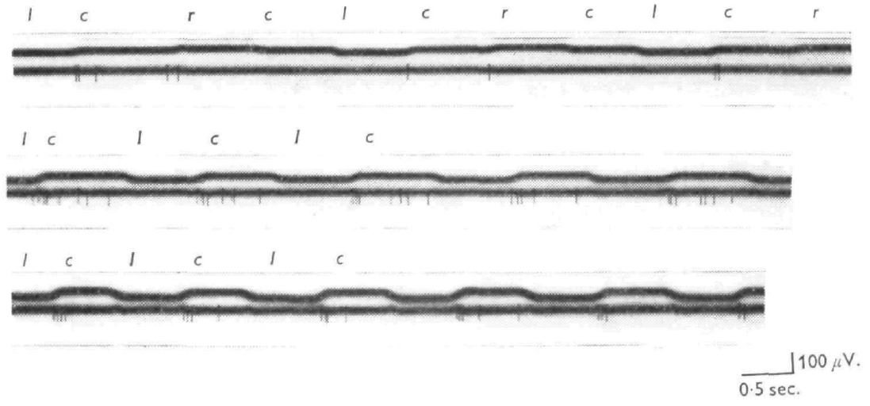
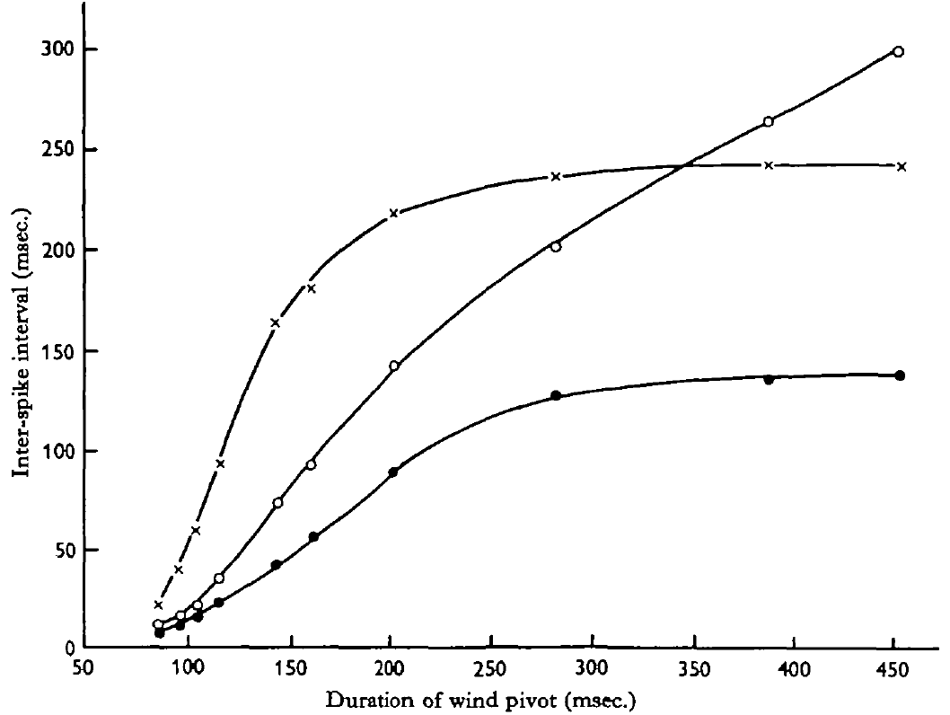
Recentre cells emphasize motion toward head-on airflow
Recentre cells are Camhi’s rapidly adapting interneurons that respond especially to airflow shifting toward the head-on direction from one preferred side. He pivoted a maintained wind jet around the head rather than repeatedly turning airflow on and off.
At 3 m/s, a shift toward center from the preferred side evoked a burst, while the reverse shift or recentring from the other side could evoke little activity. Rapid shifts were more effective than slow shifts; strong responses occurred for pivots lasting less than about 100–150 ms.
Camhi (1969), Fig. 6. Responses to wind-angle shifts toward and away from center.
The response distinguishes the direction of a change, beyond the starting and ending wind angles alone. The preparation establishes temporal and directional selectivity. Rapid shifts of this kind accompany sudden body turns in flight, when the head-wind angle changes within a fraction of a second.
Camhi (1969), Fig. 8. Pivot duration versus the first interspike intervals.
Camhi (1969b)
14
Notes:
Teaching transcript:
Recentre cells are Camhi’s rapidly adapting interneurons that respond especially to airflow shifting toward the head-on direction from one preferred side. He pivoted a maintained wind jet around the head rather than repeatedly turning airflow on and off.
At 3 m/s, a shift toward center from the preferred side evoked a burst, while the reverse shift or recentring from the other side could evoke little activity. Rapid shifts were more effective than slow shifts; strong responses occurred for pivots lasting less than about 100–150 ms.
The response distinguishes the direction of a change, beyond the starting and ending wind angles alone. The preparation establishes temporal and directional selectivity. A role in terminating corrective turns was proposed from these properties, but not verified by selective cell manipulation.
The initial and final wind angles could both lie in a region that responded to wind onset. The different pivot responses therefore cannot be explained solely by whether the final direction was within the cell’s static receptive field.
References:
J. M. Camhi (1969b). Locust wind receptors. II. Interneurones in the cervical connective. Journal of Experimental Biology 50(2):349–362. https://doi.org/10.1242/jeb.50.2.349
Camhi (1969), Fig. 6. Responses to wind-angle shifts toward and away from center.
Figure source: https://doi.org/10.1242/jeb.50.2.349
Camhi (1969), Fig. 8. Pivot duration versus the first interspike intervals.
Figure source: https://doi.org/10.1242/jeb.50.2.349

Slide 19
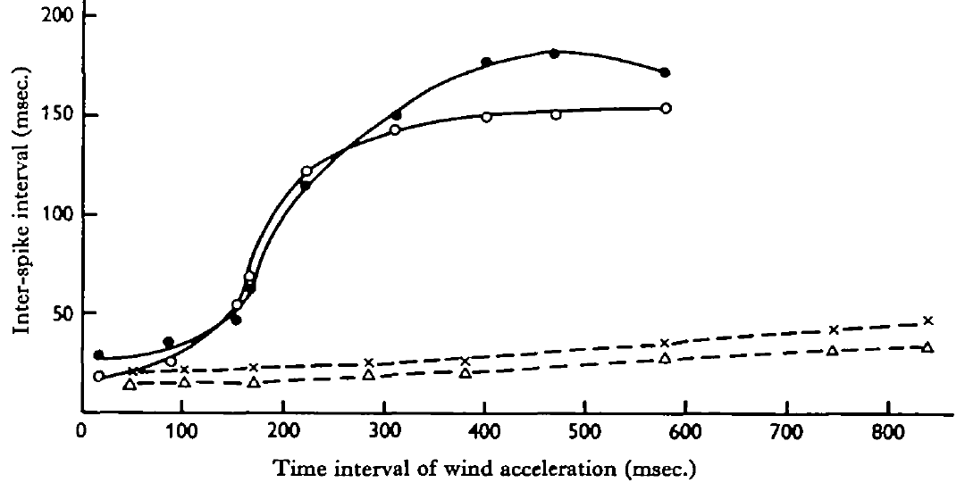
Acceleration cells emphasize rapid airflow onset
Camhi tested acceleration-sensitive interneurons by increasing wind from rest to the same final speed over different time intervals. Acceleration is the rate of change of velocity. Fixing the final speed distinguished sensitivity to onset dynamics from sensitivity to maintained speed.
These cells responded only when wind reached approximately 1–1.5 m/s or more. Faster acceleration toward 4.5 m/s produced shorter initial interspike intervals and a more vigorous burst. Directional tuning was broad, and even sizable angular pivots of an existing wind jet could fail to evoke activity.
Camhi (1969), Fig. 10. Interspike intervals as wind acceleration duration changes.
Their response therefore differs from both sustained wind-indication and directional recentring. It is consistent with a transient signal about airflow onset. Wind accelerations of 100–600 m/s² released flight in the reflex tests, so the stimuli that start flight are those that drive these cells most strongly.
Camhi (1969), Fig. 7. Head-hair sensory array supplying wind information.
Camhi (1969b); Camhi (1969a)
15
Notes:
Teaching transcript:
Camhi tested acceleration-sensitive interneurons by increasing wind from rest to the same final speed over different time intervals. Acceleration is the rate of change of velocity. Fixing the final speed distinguished sensitivity to onset dynamics from sensitivity to maintained speed.
These cells responded only when wind reached approximately 1–1.5 m/s or more. Faster acceleration toward 4.5 m/s produced shorter initial interspike intervals and a more vigorous burst. Directional tuning was broad, and even sizable angular pivots of an existing wind jet could fail to evoke activity.
Their response therefore differs from both sustained wind-indication and directional recentring. It is consistent with a transient signal about airflow onset. The recordings do not establish that acceleration cells alone initiate flight, especially because free-jump wing opening occurs faster than the tested wind reflex.
Shorter interspike intervals correspond to a higher instantaneous spike rate. The comparison held the endpoint speed constant, so changes in the initial discharge were associated with the speed of the airflow transition.
References:
J. M. Camhi (1969b). Locust wind receptors. II. Interneurones in the cervical connective. Journal of Experimental Biology 50(2):349–362. https://doi.org/10.1242/jeb.50.2.349
J. M. Camhi (1969a). Locust wind receptors. I. Transducer mechanics and sensory response. Journal of Experimental Biology 50(2):335–348. https://doi.org/10.1242/jeb.50.2.335
Camhi (1969), Fig. 10. Interspike intervals as wind acceleration duration changes.
Figure source: https://doi.org/10.1242/jeb.50.2.349
Camhi (1969), Fig. 7. Head-hair sensory array supplying wind information.
Figure source: https://doi.org/10.1242/jeb.50.2.335

Slide 20
Fast adaptation makes cells report airflow change
A change detector signals when a stimulus varies rather than its steady value. An interneuron that adapts within a fraction of a second fires briefly after a rise in its input and then falls quiet, so only fast transitions drive it strongly; a slow ramp allows adaptation to keep pace and evokes little firing.
Recentre and acceleration cells both behave this way, which accounts for short pivots and brief accelerations working best. They differ in which change they read: recentre cells need a shift in angle from one side, while acceleration cells need a rise in speed and largely ignore angle.
Camhi (1969), Fig. 6. Responses to wind-angle shifts toward and away from center.
Change detectors can also be read faster than rate-coded cells. A cell firing steadily needs several spikes before a change in its rate stands out, whereas a quiet change detector signals with its first spike, and its first interspike interval already grades how fast the airflow changed.
Camhi (1969), Fig. 8. Pivot duration versus the first interspike intervals.
Camhi (1969b)
15a
Notes:
Slides 14 and 15 describe two rapidly adapting interneuron classes. Fast adaptation explains why both prefer quick stimuli, and their inputs explain why they read different changes.
Adaptation as a filter.
A neuron whose response declines during a maintained input passes rapid changes and suppresses steady levels.
Applied to Camhi’s cells, a pivot lasting under about one or two tenths of a second produced strong responses, while slow pivots let the response fade before it built.
Angle change versus speed change.
Recentre cells were driven by shifts toward head-on from one preferred side and largely ignored the reverse shift.
Acceleration cells responded to rising speed above a threshold near one metre per second and could ignore even sizable pivots.
Speed of readout.
Against a silent background, the first spike is itself the signal, so downstream cells need not wait to average a rate.
Camhi measured the first interspike intervals for this reason: they shortened as pivots and accelerations became faster.
References:
J. M. Camhi (1969b). Locust wind receptors. II. Interneurones in the cervical connective. Journal of Experimental Biology 50(2):349–362. https://doi.org/10.1242/jeb.50.2.349

Slide 21
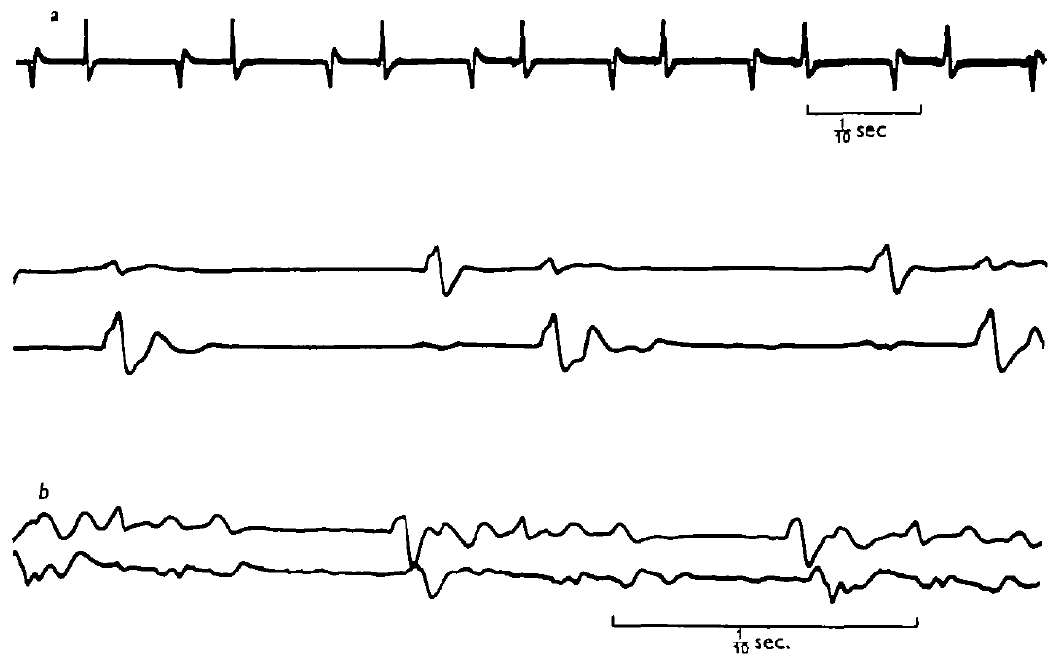
Flight-like alternation survives loss of wing feedback
A central pattern generator, or CPG, can generate rhythmic patterned output without requiring rhythmic sensory input. Wilson progressively removed wings, cut wing sensory nerves, and reduced the preparation to the head and thoracic nervous system, with limited remaining body structures.
Continuous wind at the head still elicited alternating elevator and depressor activity. Reduced preparations produced approximately 4–12 cycles/s, often near 7 cycles/s. Elevator-to-depressor delays remained around 30–40 ms in well-preserved preparations, despite the slower overall rhythm.
Wilson (1961), Fig. 6. Elevator and depressor activity after severe sensory reduction.
Wing movement and its feedback were therefore unnecessary for the basic alternation. The thoracic ganglia hold a network whose own connections time elevator and depressor bursts, and identified interneurons such as 301 and 501 belong to it. Continuous sensory excitation from the head supplied activation.
Wilson (1961), Fig. 1. Published dissection identifies ganglia, nerves and muscles.
Wilson (1961)
16
Notes:
Teaching transcript:
A central pattern generator, or CPG, can generate rhythmic patterned output without requiring rhythmic sensory input. Wilson progressively removed wings, cut wing sensory nerves, and reduced the preparation to the head and thoracic nervous system, with limited remaining body structures.
Continuous wind at the head still elicited alternating elevator and depressor activity. Reduced preparations produced approximately 4–12 cycles/s, often near 7 cycles/s. Elevator-to-depressor delays remained around 30–40 ms in well-preserved preparations, despite the slower overall rhythm.
Wing movement and its feedback were therefore unnecessary for the basic alternation. This does not mean that feedback is unnecessary for normal frequency, aerodynamic control or stable free flight. Continuous sensory excitation from the head supplied activation without specifying every phase of the rhythm.
Deafferentation removes sensory input; it must be distinguished from removal of all possible excitation. Wilson retained the head-wind pathway and supplied aeration to sustain the highly reduced nervous system.
References:
D. M. Wilson (1961). The central nervous control of flight in a locust. Journal of Experimental Biology 38(2):471–490. https://doi.org/10.1242/jeb.38.2.471
Wilson (1961), Fig. 6. Elevator and depressor activity after severe sensory reduction.
Figure source: https://doi.org/10.1242/jeb.38.2.471
Wilson (1961), Fig. 1. Published dissection identifies ganglia, nerves and muscles.
Figure source: https://doi.org/10.1242/jeb.38.2.471

Slide 22
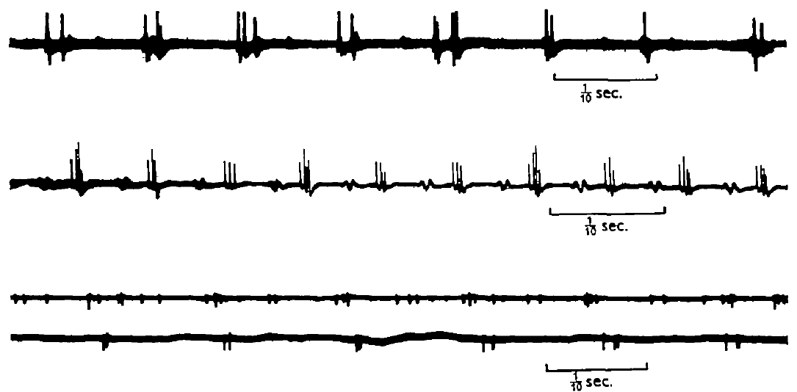
Thoracic motor axons burst without flight muscles
Wilson recorded from motor nerves in preparations lacking thoracic muscles and the abdomen. A motor axon carries the neural output toward muscle; recording its central stump tests whether rhythmic drive is produced before muscle contraction occurs.
Small bursts of spikes repeated at approximately 4–10 cycles/s. Activity in the two wing-related segments was often nearly synchronous or separated by a few milliseconds, though timing could drift over long periods. Some preparations had an irregular mesothoracic rhythm while metathoracic discharge remained orderly.
Wilson (1961), Fig. 7. Motor-nerve discharge in a muscle-free reduced preparation.
Rhythm without attached flight muscles excludes a muscle-driven reflex chain as the sole origin of the recorded bursts. An orderly metathoracic rhythm beside an irregular mesothoracic one suggests that each segment’s circuitry can oscillate partly on its own, with intersegmental coupling holding them in step.
Wilson (1961), Fig. 1. Published dissection identifies ganglia, nerves and muscles.
Wilson (1961)
17
Notes:
Teaching transcript:
Wilson recorded from motor nerves in preparations lacking thoracic muscles and the abdomen. A motor axon carries the neural output toward muscle; recording its central stump tests whether rhythmic drive is produced before muscle contraction occurs.
Small bursts of spikes repeated at approximately 4–10 cycles/s. Activity in the two wing-related segments was often nearly synchronous or separated by a few milliseconds, though timing could drift over long periods. Some preparations had an irregular mesothoracic rhythm while metathoracic discharge remained orderly.
Rhythm without attached flight muscles excludes a muscle-driven reflex chain as the sole origin of the recorded bursts. The reduced output still differed from intact flight. Preparation damage and lost feedback limit conclusions about the normal precision and contributions of each segment.
A central stump is the remaining nerve segment connected to the central nervous system after its peripheral continuation is cut. The recorded bursts were neural events rather than electrical activity produced by contracting muscle.
References:
D. M. Wilson (1961). The central nervous control of flight in a locust. Journal of Experimental Biology 38(2):471–490. https://doi.org/10.1242/jeb.38.2.471
Wilson (1961), Fig. 7. Motor-nerve discharge in a muscle-free reduced preparation.
Figure source: https://doi.org/10.1242/jeb.38.2.471
Wilson (1961), Fig. 1. Published dissection identifies ganglia, nerves and muscles.
Figure source: https://doi.org/10.1242/jeb.38.2.471

Slide 23
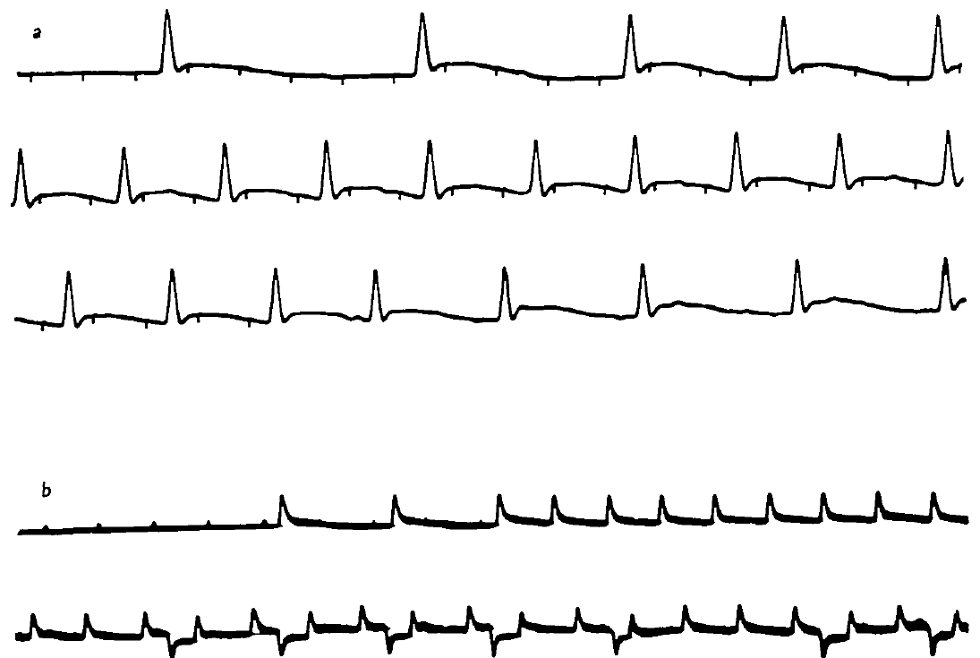
Unpatterned excitation can release patterned output
Wilson stimulated the anterior thoracic cord electrically while recording flight muscle responses in reduced preparations. A tonic drive is sustained excitation that need not repeat at the same rhythm as the motor output. Stimulation frequency and output frequency were varied independently.
Repeated stimulation could recruit alternating groups of motor activity instead of a simple one-for-one muscle response. At slower stimulation rates, some units followed the stimulus directly; at higher rates, the circuit produced a rhythm with its own changing frequency. The response depended on the recruited pathways and preparation state.
Wilson (1961), Fig. 8. Motor-unit responses to electrical stimulation of the cord.
Central circuitry can therefore transform continuing excitation into patterned alternation, arising from network interactions rather than one dedicated pacemaker neuron. Natural activation works the same way: tonic wind drive and steady 404 discharge release a rhythm whose frequency the circuit sets.
Wilson (1961), Fig. 1. Published dissection identifies ganglia, nerves and muscles.
Wilson (1961)
18
Notes:
Teaching transcript:
Wilson stimulated the anterior thoracic cord electrically while recording flight muscle responses in reduced preparations. A tonic drive is sustained excitation that need not repeat at the same rhythm as the motor output. Stimulation frequency and output frequency were varied independently.
Repeated stimulation could recruit alternating groups of motor activity instead of a simple one-for-one muscle response. At slower stimulation rates, some units followed the stimulus directly; at higher rates, the circuit produced a rhythm with its own changing frequency. The response depended on the recruited pathways and preparation state.
Central circuitry can therefore transform continuing excitation into patterned alternation. This experiment does not require a single dedicated pacemaker neuron. Electrical cord stimulation recruits multiple axons, so it cannot identify the natural activating cell or its transmitter.
Some stimulation frequencies below about 20 per second produced responses closely related to each pulse. The distinction is between stimulus-locked excitation and the organized output that emerges when excitation recruits the central network.
References:
D. M. Wilson (1961). The central nervous control of flight in a locust. Journal of Experimental Biology 38(2):471–490. https://doi.org/10.1242/jeb.38.2.471
Wilson (1961), Fig. 8. Motor-unit responses to electrical stimulation of the cord.
Figure source: https://doi.org/10.1242/jeb.38.2.471
Wilson (1961), Fig. 1. Published dissection identifies ganglia, nerves and muscles.
Figure source: https://doi.org/10.1242/jeb.38.2.471

Slide 24
Deafferentation rules out a chain-reflex rhythm
A chain reflex hypothesis holds that each wing movement stimulates sense organs whose signal triggers the opposite movement, so the rhythm exists only as a loop through the periphery. A central pattern generator instead times bursts within the nervous system itself.
Each reduction removed one possible loop. Cutting wings and wing nerves removed phasic feedback, removing thoracic muscles removed any rhythm generated by contraction, and cord stimulation replaced wind with unpatterned drive. Alternation survived every step, which a chain reflex would forbid.
Wilson (1961), Fig. 6. Elevator and depressor activity after severe sensory reduction.
The reductions also measure what feedback adds. Without it the rhythm fell from about 17 to near 7 cycles/s while elevator-to-depressor delays held at 30–40 ms, so the lost time lies between successive bursts, the interval that tegula input near threshold later shortened.
Wilson (1961), Fig. 1. Published dissection identifies ganglia, nerves and muscles.
Wilson (1961); Ausborn et al. (2007)
18a
Notes:
Wilson’s experiments on slides 16 to 18 were designed against a specific alternative, the idea that flight is a chain of reflexes. Laying out that alternative explains why each reduction was informative.
The alternative being tested.
In a chain reflex, the sensory consequence of an upstroke would be the trigger for the downstroke, and the reverse.
If that were the whole mechanism, removing the sense organs or the movement would stop the rhythm.
Three independent reductions.
Wilson removed the wings and their nerves, then the muscles, and finally drove the cord electrically.
Each manipulation removed a different candidate loop, and the alternation persisted after all of them, so a central network is required.
What feedback contributes.
The intact rhythm near seventeen cycles per second dropped to around seven, yet the delay from elevator to depressor stayed similar.
Ausborn and colleagues later found that tegula stimulation near threshold sped the deafferented rhythm, consistent with feedback shortening the part of the cycle between bursts.
References:
D. M. Wilson (1961). The central nervous control of flight in a locust. Journal of Experimental Biology 38(2):471–490. https://doi.org/10.1242/jeb.38.2.471
J. Ausborn; W. Stein; H. Wolf (2007). Frequency control of motor patterning by negative sensory feedback. Journal of Neuroscience 27(35):9319–9328. https://doi.org/10.1523/JNEUROSCI.0907-07.2007

Slide 25
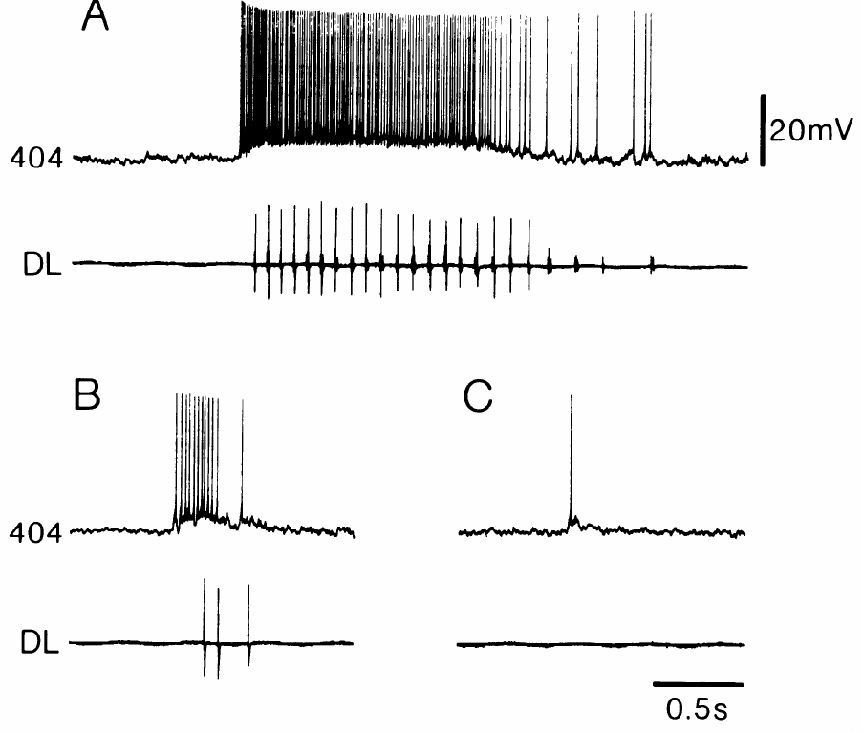
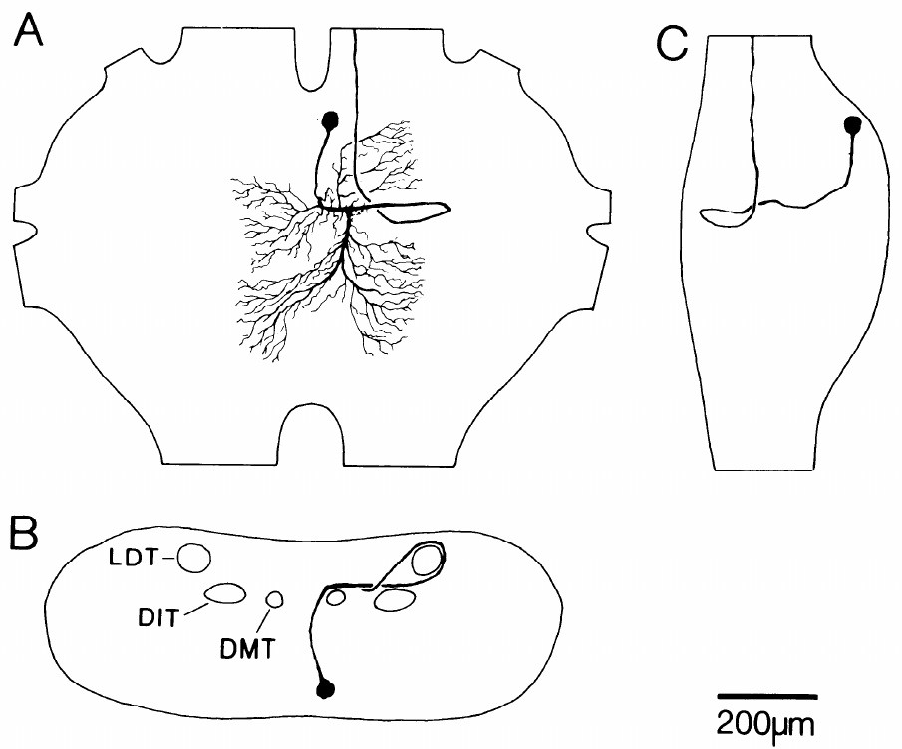
The 404 group links sensory input to flight activation
Pearson and colleagues recorded and dye-filled 404 interneurons in Locusta migratoria. These mesothoracic cells have looping main neurites and ascending axons. A neurite is a neuronal process; dye filling linked the physiological recordings to recognizable anatomy.
404 neurons fired tonically during flight episodes initiated by wind or a sudden reduction in illumination. The same neuron responded weakly to turning the light back on, without releasing flight. It generally lacked the strong cycle-by-cycle oscillation characteristic of the rhythm-generating circuit.
This separates an activating pathway from neurons that determine successive phases. Darkness and wind both raised 404 firing, so visual and mechanosensory triggers for flight converge on the same thoracic cells. Tonic activity supplies drive rather than a complete motor score.
Pearson et al. (1985), Fig. 1. Filled 404 neuron in the thoracic nervous system.
Pearson et al. (1985), Fig. 2. 404 discharge during wind and changing illumination.
Pearson et al. (1985)
19
Notes:
Teaching transcript:
Pearson and colleagues recorded and dye-filled 404 interneurons in Locusta migratoria. These mesothoracic cells have looping main neurites and ascending axons. A neurite is a neuronal process; dye filling linked the physiological recordings to recognizable anatomy.
404 neurons fired tonically during flight episodes initiated by wind or a sudden reduction in illumination. The same neuron responded weakly to turning the light back on, without releasing flight. It generally lacked the strong cycle-by-cycle oscillation characteristic of the rhythm-generating circuit.
This separates an activating pathway from neurons that determine successive phases. The small 404 group contains physiological and anatomical variation, so results from one member do not imply identical sensory input to every member. Tonic activity supplies drive rather than a complete motor score.
The investigators correlated physiological identification with Lucifer-yellow morphology. Closely adjacent neurons had parallel neurites and axons, supporting a group of cells rather than one neuron with unlimited variation.
References:
K. G. Pearson; D. N. Reye; D. W. Parsons; G. Bicker (1985). Flight-initiating interneurons in the locust. Journal of Neurophysiology 53(4):910–925. https://doi.org/10.1152/jn.1985.53.4.910
Pearson et al. (1985), Fig. 2. 404 discharge during wind and changing illumination.
Figure source: https://doi.org/10.1152/jn.1985.53.4.910
Pearson et al. (1985), Fig. 1. Filled 404 neuron in the thoracic nervous system.
Figure source: https://doi.org/10.1152/jn.1985.53.4.910

Slide 26
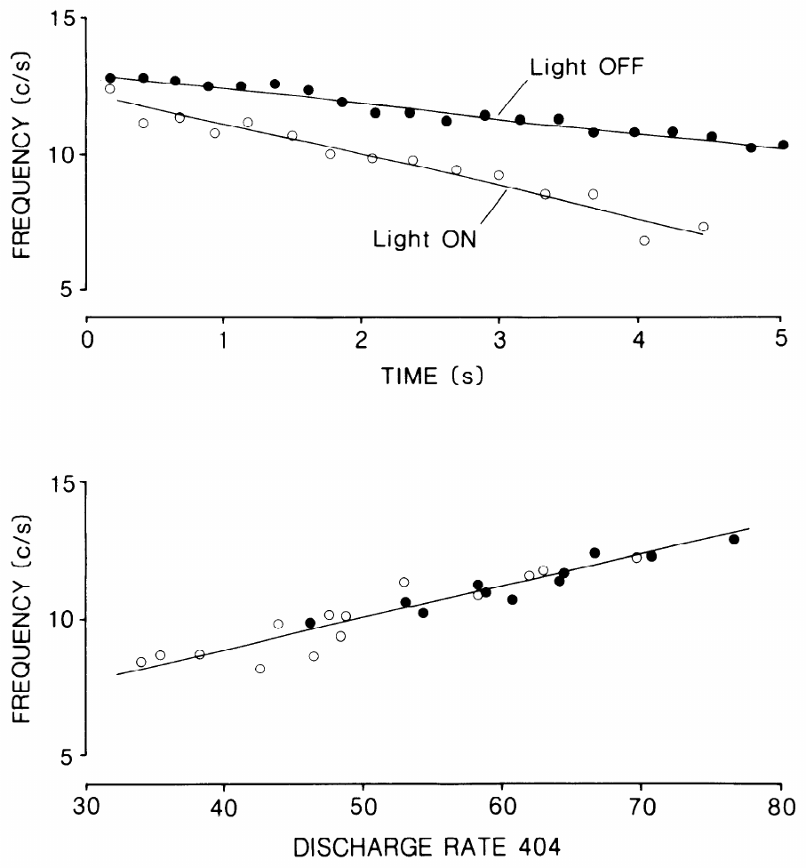
404 discharge tracks the frequency of fictive flight
In Pearson and colleagues’ preparation, the discharge rate of a 404 neuron declined during a sustained wind stimulus as the frequency of flight activity declined. Fictive flight is flight-like neural or muscle output in a reduced preparation, rather than aerodynamic flight through space.
Higher 404 firing rates were associated with faster flight rhythms. Turning the lights off increased both 404 activity and rhythm frequency while preserving the relationship between them. Flight commonly ended after the recorded 404 discharge fell below approximately 50 spikes/s.
The association is consistent with an excitatory drive that regulates circuit activation. A linear relation between discharge rate and flight frequency allows the network to read 404 drive as a graded speed command, and injected current confirmed the causal direction.
Pearson et al. (1985), Fig. 1. Filled 404 neuron in the thoracic nervous system.
Pearson et al. (1985), Fig. 3. 404 firing rate versus flight rhythm frequency.
Pearson et al. (1985)
20
Notes:
Teaching transcript:
In Pearson and colleagues’ preparation, the discharge rate of a 404 neuron declined during a sustained wind stimulus as the frequency of flight activity declined. Fictive flight is flight-like neural or muscle output in a reduced preparation, rather than aerodynamic flight through space.
Higher 404 firing rates were associated with faster flight rhythms. Turning the lights off increased both 404 activity and rhythm frequency while preserving the relationship between them. Flight commonly ended after the recorded 404 discharge fell below approximately 50 spikes/s.
The association is consistent with an excitatory drive that regulates circuit activation. Correlation alone does not prove that 404 firing causes the frequency change, because both could respond to another input. Current-injection experiments supplied the additional causal test.
The figure’s discharge-rate axis is in impulses per second and its flight-frequency axis in cycles per second. These are different rates: one activating interneuron can fire several spikes during each motor cycle.
References:
K. G. Pearson; D. N. Reye; D. W. Parsons; G. Bicker (1985). Flight-initiating interneurons in the locust. Journal of Neurophysiology 53(4):910–925. https://doi.org/10.1152/jn.1985.53.4.910
Pearson et al. (1985), Fig. 3. 404 firing rate versus flight rhythm frequency.
Figure source: https://doi.org/10.1152/jn.1985.53.4.910
Pearson et al. (1985), Fig. 1. Filled 404 neuron in the thoracic nervous system.
Figure source: https://doi.org/10.1152/jn.1985.53.4.910

Slide 27
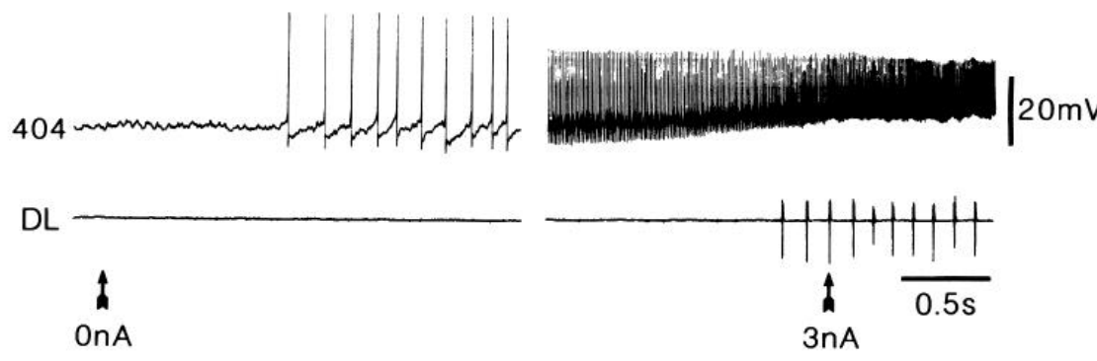
Depolarizing one 404 neuron can initiate the flight rhythm
Depolarization makes membrane voltage less negative and can increase neuronal firing. Pearson and colleagues injected depolarizing current into a single 404 neuron while recording dorsal longitudinal muscle activity and, in additional trials, an elevator or depressor motor neuron.
Flight-like bursts often began when the stimulated 404 neuron reached approximately 100 spikes/s. Current-evoked rhythms commonly started near 8 cycles/s, slower than the approximately 12 cycles/s initially recorded during wind-induced episodes. Motor-neuron voltage oscillations resembled those evoked by wind.
Pearson et al. (1985), Fig. 6. Flight-related motor bursts during 404 current injection.
This is causal evidence that one 404 neuron can recruit the central flight program. A steady, unpatterned depolarization of one cell produced rhythmic alternation, so the timing of each cycle comes from the network it drives, as with Wilson’s cord stimulation.
Pearson et al. (1985), Fig. 1. Filled 404 neuron in the thoracic nervous system.
Pearson et al. (1985)
21
Notes:
Teaching transcript:
Depolarization makes membrane voltage less negative and can increase neuronal firing. Pearson and colleagues injected depolarizing current into a single 404 neuron while recording dorsal longitudinal muscle activity and, in additional trials, an elevator or depressor motor neuron.
Flight-like bursts often began when the stimulated 404 neuron reached approximately 100 spikes/s. Current-evoked rhythms commonly started near 8 cycles/s, slower than the approximately 12 cycles/s initially recorded during wind-induced episodes. Motor-neuron voltage oscillations resembled those evoked by wind.
This is causal evidence that one 404 neuron can recruit the central flight program. It establishes sufficiency in favorable preparations, not that the cell acts alone in the intact animal. Wind normally activates several pathways, whereas current injection selectively increases one neuron’s drive.
The simultaneous intracellular motor recordings excluded an interpretation in which 404 merely excited a depressor muscle tonically. Elevator and depressor membrane potentials developed patterned oscillations instead.
References:
K. G. Pearson; D. N. Reye; D. W. Parsons; G. Bicker (1985). Flight-initiating interneurons in the locust. Journal of Neurophysiology 53(4):910–925. https://doi.org/10.1152/jn.1985.53.4.910
Pearson et al. (1985), Fig. 6. Flight-related motor bursts during 404 current injection.
Figure source: https://doi.org/10.1152/jn.1985.53.4.910
Pearson et al. (1985), Fig. 1. Filled 404 neuron in the thoracic nervous system.
Figure source: https://doi.org/10.1152/jn.1985.53.4.910

Slide 28
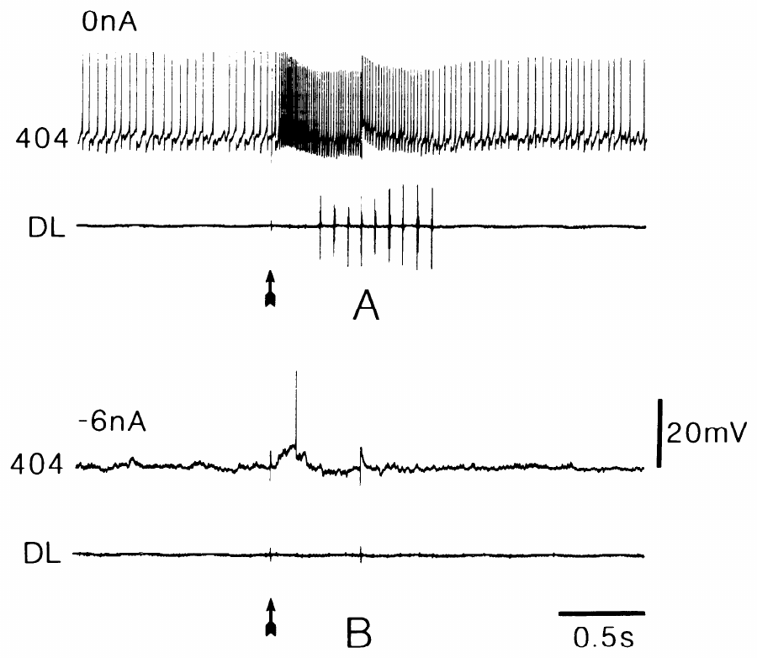
Hyperpolarizing one 404 neuron can prevent initiation
Hyperpolarization makes membrane voltage more negative and can suppress firing. Pearson and colleagues compared a brief wind pulse before and during hyperpolarizing current injection into a recorded 404 neuron. The stimulus was otherwise unchanged.
A 0.5 s wind pulse normally evoked a short flight episode. During approximately 6 nA of hyperpolarizing current, the recorded 404 cell produced only one impulse and the same stimulus failed to initiate the flight rhythm. Suppression was most effective with weaker wind or near the end of an episode.
A single member of the activating group can therefore influence whether the circuit reaches its activation threshold. Hyperpolarizing a 404 neuron during an ongoing episode also slowed or stopped the rhythm, matching the link between 404 firing rate and flight frequency.
Pearson et al. (1985), Fig. 1. Filled 404 neuron in the thoracic nervous system.
Pearson et al. (1985), Fig. 9. A repeated wind pulse with and without 404 inhibition.
Pearson et al. (1985)
22
Notes:
Teaching transcript:
Hyperpolarization makes membrane voltage more negative and can suppress firing. Pearson and colleagues compared a brief wind pulse before and during hyperpolarizing current injection into a recorded 404 neuron. The stimulus was otherwise unchanged.
A 0.5 s wind pulse normally evoked a short flight episode. During approximately 6 nA of hyperpolarizing current, the recorded 404 cell produced only one impulse and the same stimulus failed to initiate the flight rhythm. Suppression was most effective with weaker wind or near the end of an episode.
A single member of the activating group can therefore influence whether the circuit reaches its activation threshold. The condition dependence prevents interpreting this as universal necessity of one cell. Other 404 neurons and parallel inputs can contribute enough drive under stronger stimulation.
The current manipulation altered the neuron while retaining the wind stimulus. Its effectiveness varied with the available background excitation, which is expected for a distributed activating pathway.
References:
K. G. Pearson; D. N. Reye; D. W. Parsons; G. Bicker (1985). Flight-initiating interneurons in the locust. Journal of Neurophysiology 53(4):910–925. https://doi.org/10.1152/jn.1985.53.4.910
Pearson et al. (1985), Fig. 9. A repeated wind pulse with and without 404 inhibition.
Figure source: https://doi.org/10.1152/jn.1985.53.4.910
Pearson et al. (1985), Fig. 1. Filled 404 neuron in the thoracic nervous system.
Figure source: https://doi.org/10.1152/jn.1985.53.4.910

Slide 29
404 cells are sufficient but not always necessary
Sufficiency means that activating an element produces an outcome; necessity means that removing it prevents the outcome. Depolarizing one 404 neuron tests sufficiency, and hyperpolarizing it during wind tests necessity, so the two current directions answer different questions about the same cell.
One 404 cell passed the sufficiency test in quiescent preparations. The necessity test was conditional: in some preparations flight continued while current abolished every spike in the recorded cell.
That pattern fits a pool of activating neurons whose drive adds up, with the rhythm generated elsewhere. The 404 cells showed no detectable input from the rhythm generator, so the flight system is organized in levels: tonic drive from above, and cycle timing within the thoracic network.
Pearson et al. (1985), Fig. 1. Filled 404 neuron in the thoracic nervous system.
Pearson et al. (1985), Fig. 9. A repeated wind pulse with and without 404 inhibition.
Pearson et al. (1985)
22a
Notes:
Slides 21 and 22 apply opposite currents to the same kind of cell. The two experiments answer two different logical questions, and the answers together define the role of the 404 group.
Two questions, two manipulations.
Adding current asks whether a cell can start flight on its own; removing its activity asks whether flight still happens without it.
A cell can pass the first test and fail the second when other neurons provide the same kind of drive.
What the 404 results give.
Pearson and colleagues found that depolarizing a single 404 neuron often started flight in a quiescent preparation.
They also found that flight sometimes persisted when all spiking in a 404 neuron was prevented, so each cell is one contributor among several.
A layered circuit.
None of their data indicated that 404 neurons receive input from the central rhythm generator.
The authors therefore described flight circuitry as hierarchical, with a tonic drive system that initiates and maintains activity in a separate patterning system.
References:
K. G. Pearson; D. N. Reye; D. W. Parsons; G. Bicker (1985). Flight-initiating interneurons in the locust. Journal of Neurophysiology 53(4):910–925. https://doi.org/10.1152/jn.1985.53.4.910

Slide 30
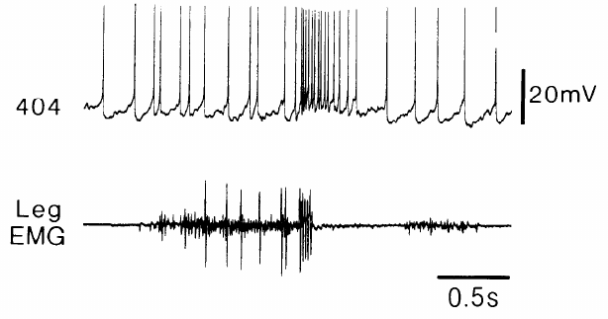
404 bursts may link jumping to the start of flight
Pearson and colleagues recorded a 404 neuron together with hindleg muscle activity during kicks. A kick uses coordinated flexor and extensor activation followed by rapid extension. Its motor organization resembles that used to launch a jump.
The 404 neuron produced a brief high-frequency burst beginning just before the kick was triggered. Rapid extension driven by the fast extensor motor neuron alone did not produce the same pattern. The published recording retains a 0.5 s time calibration and a 20 mV voltage calibration.
Pearson et al. (1985), Fig. 11. 404 activity near the trigger of a hindleg kick.
The temporal relationship and the ability of 404 stimulation to release flight support a possible central link between jump-related activity and flight initiation. A 404 burst just before take-off is a candidate route for wing opening within about 15 ms of jump onset, well ahead of the fastest wind reflex.
Pearson et al. (1985), Fig. 1. Filled 404 neuron in the thoracic nervous system.
Pearson et al. (1985)
23
Notes:
Teaching transcript:
Pearson and colleagues recorded a 404 neuron together with hindleg muscle activity during kicks. A kick uses coordinated flexor and extensor activation followed by rapid extension. Its motor organization resembles that used to launch a jump.
The 404 neuron produced a brief high-frequency burst beginning just before the kick was triggered. Rapid extension driven by the fast extensor motor neuron alone did not produce the same pattern. The published recording retains a 0.5 s time calibration and a 20 mV voltage calibration.
The temporal relationship and the ability of 404 stimulation to release flight support a possible central link between jump-related activity and flight initiation. The source of the kick-associated excitation was unresolved. These recordings were not direct proof that 404 neurons trigger wing opening during natural jumps.
The authors considered both central input from the kick circuitry and proprioceptive input near the end of muscle co-contraction. The preparation did not selectively separate those two explanations.
References:
K. G. Pearson; D. N. Reye; D. W. Parsons; G. Bicker (1985). Flight-initiating interneurons in the locust. Journal of Neurophysiology 53(4):910–925. https://doi.org/10.1152/jn.1985.53.4.910
Pearson et al. (1985), Fig. 11. 404 activity near the trigger of a hindleg kick.
Figure source: https://doi.org/10.1152/jn.1985.53.4.910
Pearson et al. (1985), Fig. 1. Filled 404 neuron in the thoracic nervous system.
Figure source: https://doi.org/10.1152/jn.1985.53.4.910

Slide 31
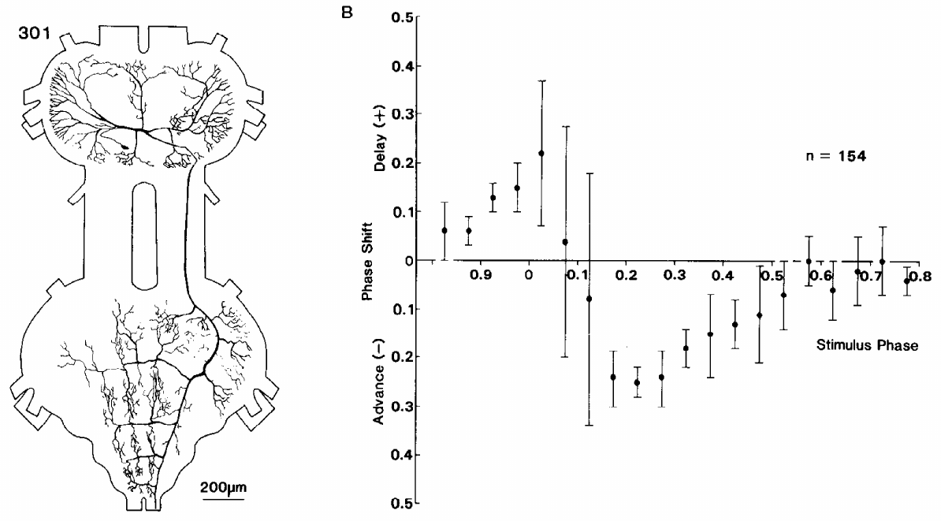
Interneuron 301 can advance or delay the next cycle
A neuron’s rhythmic firing does not by itself establish that it helps generate the rhythm. Robertson and Pearson injected brief current pulses into identified interneuron 301 during fictive flight and measured the timing of subsequent dorsal longitudinal motor bursts.
A 30 ms depolarizing pulse could advance or delay the next cycle depending on when it occurred. Phase specifies the position within a repeating cycle; a phase-response curve relates the timing of a perturbation to its effect on the rhythm. The neuron’s branches span mesothoracic and metathoracic regions.
Phase-dependent resetting supplies causal evidence for participation in rhythm generation. 301 fires with elevator-related activity, and its branches in two thoracic ganglia suit it to coordinate forewing and hindwing circuits within one rhythm.
Robertson & Pearson (1985), Fig. 1. 301 anatomy and phase-response measurements.
Robertson & Pearson (1985)
24
Notes:
Teaching transcript:
A neuron’s rhythmic firing does not by itself establish that it helps generate the rhythm. Robertson and Pearson injected brief current pulses into identified interneuron 301 during fictive flight and measured the timing of subsequent dorsal longitudinal motor bursts.
A 30 ms depolarizing pulse could advance or delay the next cycle depending on when it occurred. Phase specifies the position within a repeating cycle; a phase-response curve relates the timing of a perturbation to its effect on the rhythm. The neuron’s branches span mesothoracic and metathoracic regions.
Phase-dependent resetting supplies causal evidence for participation in rhythm generation. It does not prove that 301 is the sole oscillator or that the tested pulse reproduces its natural synaptic input. The response must be interpreted within the connected flight network.
Advancing a cycle makes the next burst occur earlier; delaying it makes the burst occur later. The stimulation was timed relative to the motor rhythm, so a fixed current pulse had different effects in different circuit states.
References:
R. M. Robertson; K. G. Pearson (1985). Neural circuits in the flight system of the locust. Journal of Neurophysiology 53(1):110–128. https://doi.org/10.1152/jn.1985.53.1.110
Robertson & Pearson (1985), Fig. 1. 301 anatomy and phase-response measurements.
Figure source: https://doi.org/10.1152/jn.1985.53.1.110

Slide 32
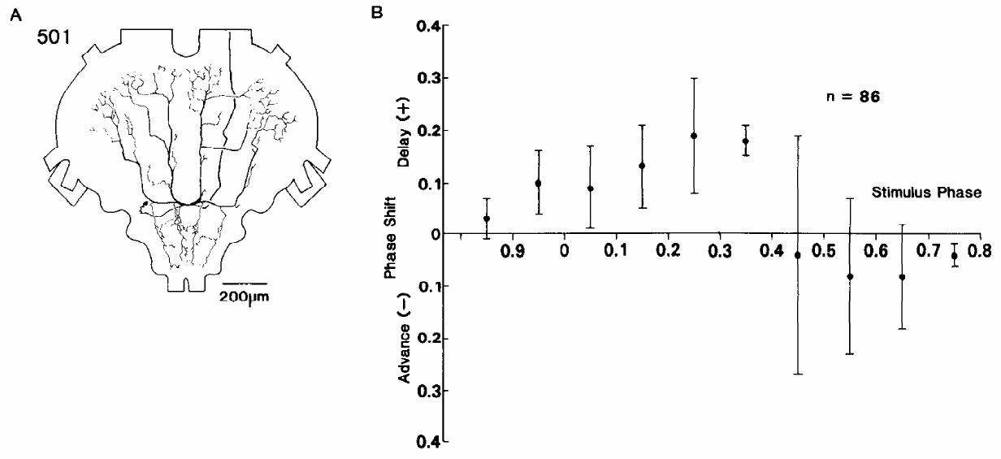
Interneuron 501 supplies phase-dependent delays
Robertson and Pearson tested interneuron 501 with the same phase-dependent current-injection approach used for 301. The dye-filled cell was identified within the metathoracic ganglion. Both neurons expressed flight-related activity, but their resetting effects differed.
Brief depolarizing pulses into 501 reliably delayed the following cycle over particular phases. Apparent advances were not clearly separable from ordinary cycle variation. Its inhibitory connections included elevator-related pathways, whereas its own burst was associated with the depressor phase.
The distinction between 301 and 501 argues against treating every rhythmically active interneuron as functionally interchangeable. 501 can alter when the network moves into its following cycle. It also inhibits 301 within about 3 ms, so the two resetting cells are directly connected.
Robertson & Pearson (1985), Fig. 2. 501 morphology and resetting curve.
Robertson & Pearson (1985)
25
Notes:
Teaching transcript:
Robertson and Pearson tested interneuron 501 with the same phase-dependent current-injection approach used for 301. The dye-filled cell was identified within the metathoracic ganglion. Both neurons expressed flight-related activity, but their resetting effects differed.
Brief depolarizing pulses into 501 reliably delayed the following cycle over particular phases. Apparent advances were not clearly separable from ordinary cycle variation. Its inhibitory connections included elevator-related pathways, whereas its own burst was associated with the depressor phase.
The distinction between 301 and 501 argues against treating every rhythmically active interneuron as functionally interchangeable. 501 can alter when the network moves into its next cycle. Current injection establishes a network effect while leaving other neurons and parallel oscillatory mechanisms available.
The published resetting curve uses normalized cycle timing. Normalization permits comparison between slightly different cycle periods without equating the firing rate of the interneuron with the frequency of wing beating.
References:
R. M. Robertson; K. G. Pearson (1985). Neural circuits in the flight system of the locust. Journal of Neurophysiology 53(1):110–128. https://doi.org/10.1152/jn.1985.53.1.110
Robertson & Pearson (1985), Fig. 2. 501 morphology and resetting curve.
Figure source: https://doi.org/10.1152/jn.1985.53.1.110

Slide 33
Resetting separates oscillator parts from followers
A phase-response curve plots how far a brief pulse shifts later cycles against the phase at which it arrives. Its logic rests on a property of oscillators: the timing of the rhythm is held in the state of its own elements, so pushing one element moves every cycle that follows.
A follower neuron behaves differently. Driving it changes its own spikes, but the oscillator keeps its schedule and the motor burst arrives on time. Resetting by 301 and 501 therefore places both cells inside the timing machinery rather than downstream of it.
The shape of each curve also points to each cell’s job. Advances and delays from 301 mean it can hasten or postpone the transition it helps start, whereas consistent delays from 501, which fires with the depressor phase and inhibits elevator pathways, fit a cell that prolongs the phase in which it is active.
Robertson & Pearson (1985), Fig. 1. 301 anatomy and phase-response measurements.
Robertson & Pearson (1985)
25a
Notes:
Slides 24 and 25 report resetting curves for two interneurons. The reasoning behind the test explains why a shifted cycle counts as evidence for rhythm generation.
What a resetting test asks.
A pulse is delivered at a chosen point in the cycle, and the arrival time of later motor bursts is compared with the expected schedule.
If the schedule shifts permanently, the pulse changed the oscillator itself.
Followers do not reset.
A motor neuron or any purely downstream cell can be driven to fire extra spikes without changing when the rhythm generator produces its following burst.
Robertson and Pearson concluded from the resetting experiments that 301 and 501 are important in rhythm generation.
Reading the cell’s role from the curve.
301 is associated with elevator activity and could both advance and delay cycles.
501 bursts with the depressor phase and inhibits elevator-related cells, so extra excitation of 501 lengthens the depressor phase and delays the cycle.
References:
R. M. Robertson; K. G. Pearson (1985). Neural circuits in the flight system of the locust. Journal of Neurophysiology 53(1):110–128. https://doi.org/10.1152/jn.1985.53.1.110

Slide 34
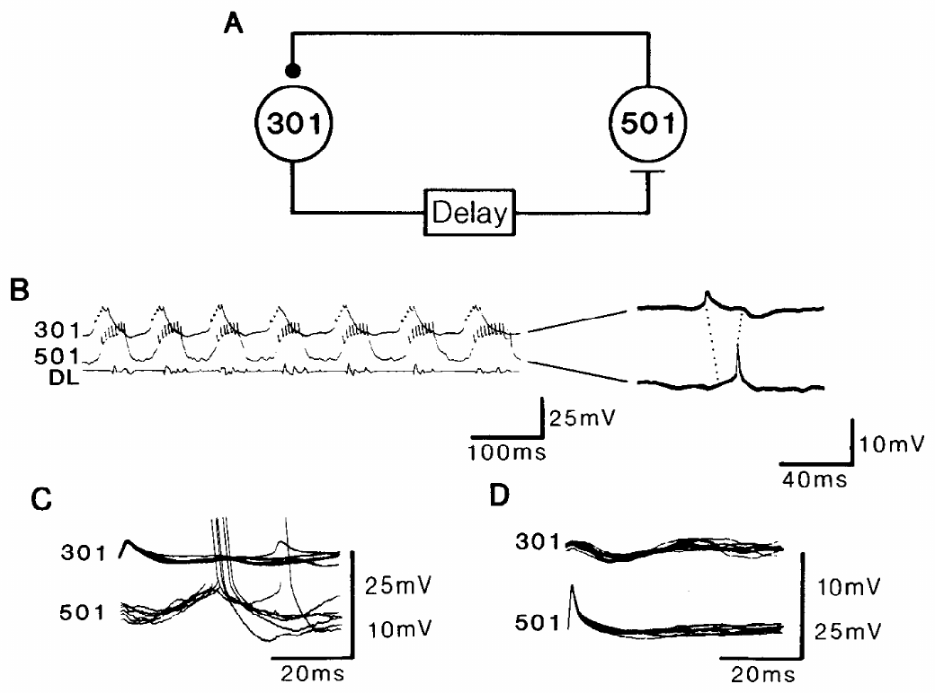
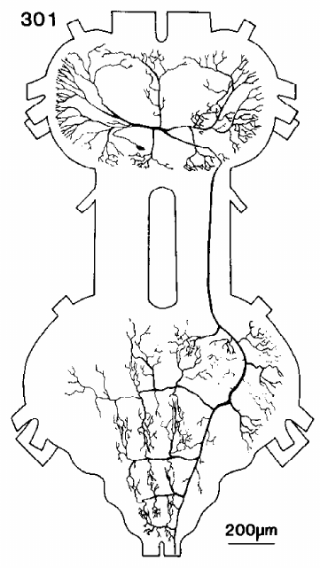
Delayed excitation and fast inhibition couple 301 and 501
Robertson and Pearson recorded simultaneously from interneurons 301 and 501. A postsynaptic potential is a change in membrane voltage caused by input from another neuron. An excitatory potential tends to favor firing; an inhibitory potential tends to oppose it under the recorded conditions.
A spike in 301 preceded a depolarizing potential in 501 by approximately 6 ms. A spike in 501 preceded an inhibitory potential in 301 by approximately 3 ms. The delayed excitation lasted longer than the feedback inhibition and could support alternating activation and release from inhibition.
Robertson & Pearson (1985), Fig. 3. Paired recordings of delayed excitation and feedback inhibition.
These paired recordings establish directional physiological interactions. Each 301 spike excites 501 after a delay, and each 501 spike quickly inhibits 301, so 301 activity recruits the cell that ends it. Such a reciprocal pair is a circuit motif suited to promoting rhythmic bursting.
Robertson & Pearson (1985), Fig. 1(A). Filled interneuron 301 across two thoracic ganglia.
Robertson & Pearson (1985)
26
Notes:
Teaching transcript:
Robertson and Pearson recorded simultaneously from interneurons 301 and 501. A postsynaptic potential is a change in membrane voltage caused by input from another neuron. An excitatory potential tends to favor firing; an inhibitory potential tends to oppose it under the recorded conditions.
A spike in 301 preceded a depolarizing potential in 501 by approximately 6 ms. A spike in 501 preceded an inhibitory potential in 301 by approximately 3 ms. The delayed excitation lasted longer than the feedback inhibition and could support alternating activation and release from inhibition.
These paired recordings establish directional physiological interactions. A longer latency suggests additional processing but does not alone count synapses. The 301-to-501 depolarization required further tests because depolarization can arise from removal of inhibition rather than direct excitatory transmitter action.
Excitation from 301 to 501 and inhibition returning from 501 to 301 form a candidate burst-generating interaction. Long depolarizing current pulses into 301 sometimes recruited rhythmical output, but other components of the flight network remained active.
References:
R. M. Robertson; K. G. Pearson (1985). Neural circuits in the flight system of the locust. Journal of Neurophysiology 53(1):110–128. https://doi.org/10.1152/jn.1985.53.1.110
Robertson & Pearson (1985), Fig. 3. Paired recordings of delayed excitation and feedback inhibition.
Figure source: https://doi.org/10.1152/jn.1985.53.1.110
Robertson & Pearson (1985), Fig. 1(A). Filled interneuron 301 across two thoracic ganglia.
Figure source: https://doi.org/10.1152/jn.1985.53.1.110

Slide 35
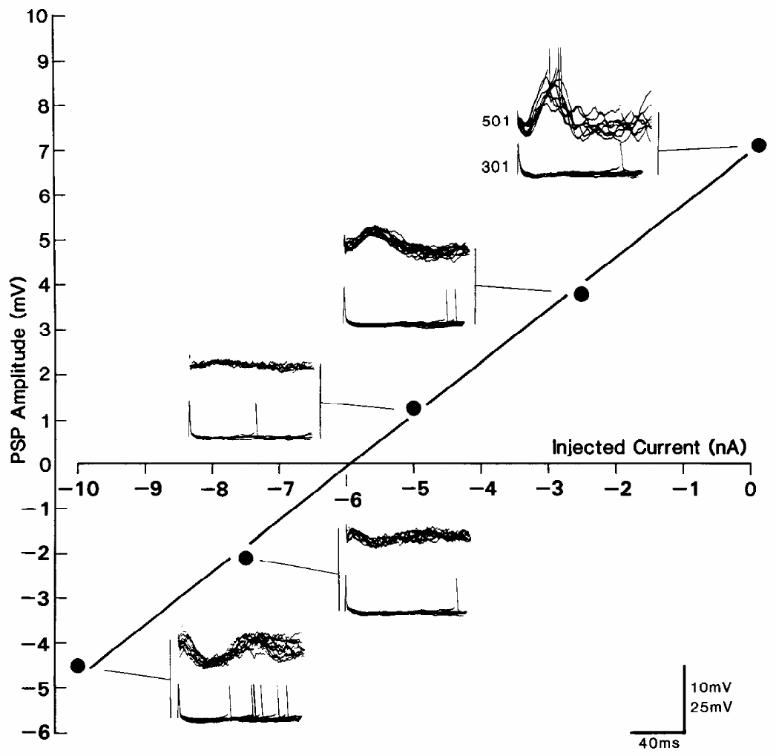
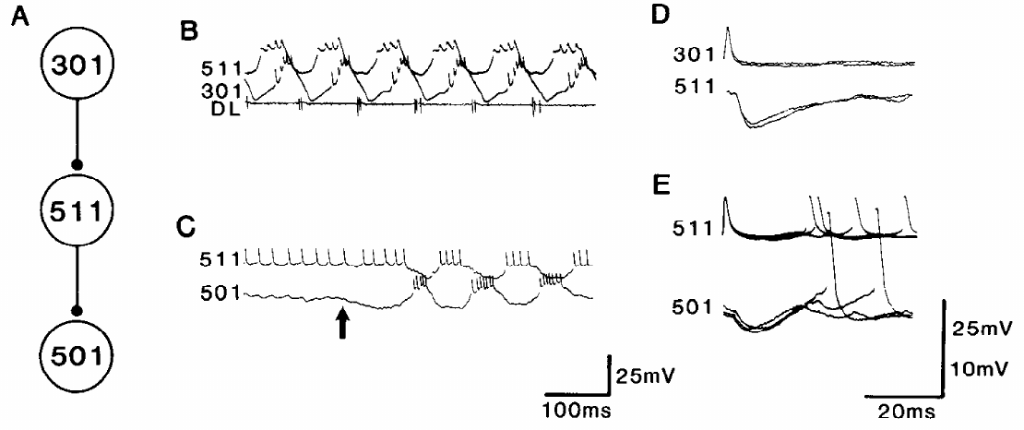
A depolarizing response can arise from disinhibition
Disinhibition is excitation caused by reducing an inhibitory influence. Robertson and Pearson hyperpolarized 501 while monitoring its delayed response to 301 spikes. A direct increase in excitatory conductance and a reduction in inhibitory conductance need not behave the same way when membrane voltage changes.
The delayed depolarizing potential decreased and reversed sign near 6 nA of hyperpolarizing current. Spontaneous inhibitory potentials reversed at a similar point. Chloride loading reduced the delayed potential, consistent with an inhibitory conductance contributing to its origin.
An identified pathway through interneuron 511 contained inhibition from 301 to 511 and from 511 to 501. In the authors’ interpretation, 301 inhibits graded, tonic transmitter release from intercalated neurons, so the delayed excitation travels a disynaptic route.
Robertson & Pearson (1985), Fig. 7. Recorded inhibitory links through interneuron 511.
Robertson & Pearson (1985), Fig. 6. Delayed potentials reverse during hyperpolarizing current injection.
Robertson & Pearson (1985)
27
Notes:
Teaching transcript:
Disinhibition is excitation caused by reducing an inhibitory influence. Robertson and Pearson hyperpolarized 501 while monitoring its delayed response to 301 spikes. A direct increase in excitatory conductance and a reduction in inhibitory conductance need not behave the same way when membrane voltage changes.
The delayed depolarizing potential decreased and reversed sign near 6 nA of hyperpolarizing current. Spontaneous inhibitory potentials reversed at a similar point. Chloride loading reduced the delayed potential, consistent with an inhibitory conductance contributing to its origin.
An identified pathway through interneuron 511 contained inhibition from 301 to 511 and from 511 to 501. The observations support delayed excitation through disinhibition, but tonic graded transmitter release at the candidate intermediate connection was not directly established.
A conductance describes how readily ionic current passes across the membrane. Reversing an inhibitory current’s driving force can reverse a response produced by removing that current. The absolute reversal voltage was difficult to determine with the recording method.
References:
R. M. Robertson; K. G. Pearson (1985). Neural circuits in the flight system of the locust. Journal of Neurophysiology 53(1):110–128. https://doi.org/10.1152/jn.1985.53.1.110
Robertson & Pearson (1985), Fig. 6. Delayed potentials reverse during hyperpolarizing current injection.
Figure source: https://doi.org/10.1152/jn.1985.53.1.110
Robertson & Pearson (1985), Fig. 7. Recorded inhibitory links through interneuron 511.
Figure source: https://doi.org/10.1152/jn.1985.53.1.110

Slide 36
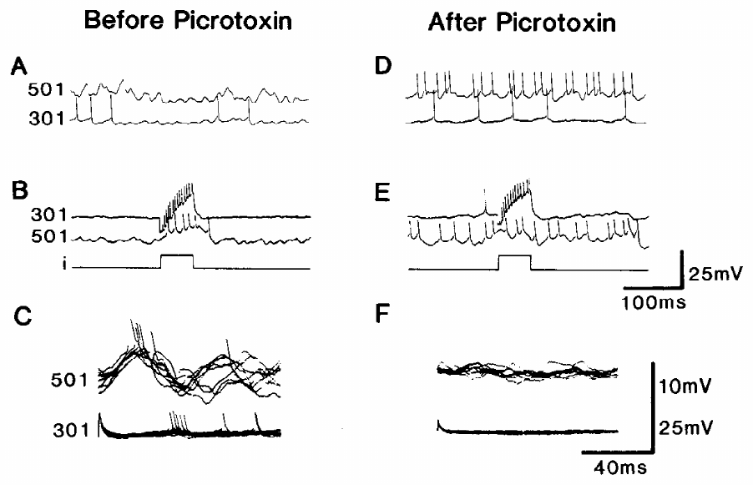
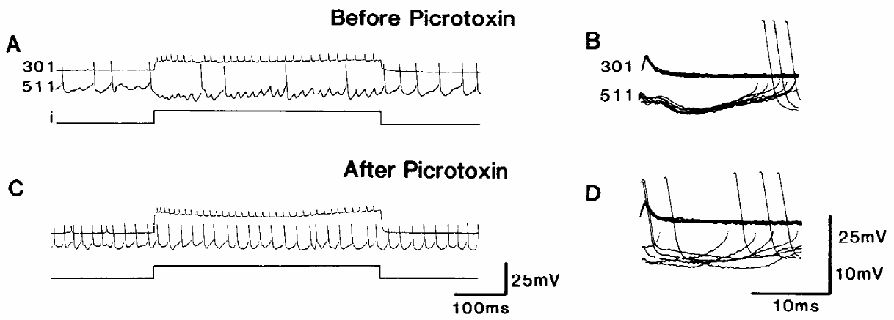
Picrotoxin disrupts inhibition and delayed excitation
Robertson and Pearson applied picrotoxin, an inhibitor of certain ligand-gated inhibitory channel responses, to test the proposed disinhibitory pathway. The bath concentration was approximately 150 μM. Paired recordings compared the same connections before and after treatment.
Within about 4 min, picrotoxin blocked inhibition from 301 to 511 and also the delayed excitation from 301 to 501. Neuron 501 became strongly depolarized and could fire continuously. Rhythmic activity sometimes persisted at 16–18 Hz instead of the usual 10–12 Hz, with altered bursts and disrupted phase relationships.
Robertson & Pearson (1985), Fig. 9. 301-to-501 responses before and after picrotoxin.
Blocking an inhibitory influence can remove a depolarizing response that depends on disinhibition. The faster rhythm with disrupted phases that persisted under picrotoxin indicates that inhibitory connections set both cycle timing and phase, while other oscillatory mechanisms survive the block.
Robertson & Pearson (1985), Fig. 8. Picrotoxin blocks the recorded 301-to-511 inhibitory potential.
Robertson & Pearson (1985)
28
Notes:
Teaching transcript:
Robertson and Pearson applied picrotoxin, an inhibitor of certain ligand-gated inhibitory channel responses, to test the proposed disinhibitory pathway. The bath concentration was approximately 150 μM. Paired recordings compared the same connections before and after treatment.
Within about 4 min, picrotoxin blocked inhibition from 301 to 511 and also the delayed excitation from 301 to 501. Neuron 501 became strongly depolarized and could fire continuously. Rhythmic activity sometimes persisted at 16–18 Hz instead of the usual 10–12 Hz, with altered bursts and disrupted phase relationships.
Blocking an inhibitory influence can remove a depolarizing response that depends on disinhibition. The result supports that mechanism but does not identify a particular inhibitory transmitter or receptor subunit. Persistent, distorted rhythmicity also argues against assigning all oscillation to this one interaction.
The drug’s effects on multiple pathways limit molecular specificity. Failure to recover the connection during limited washout also restricts interpretation. The observed physiological block should not be converted into a definitive identification of a GABA receptor subtype.
References:
R. M. Robertson; K. G. Pearson (1985). Neural circuits in the flight system of the locust. Journal of Neurophysiology 53(1):110–128. https://doi.org/10.1152/jn.1985.53.1.110
Robertson & Pearson (1985), Fig. 9. 301-to-501 responses before and after picrotoxin.
Figure source: https://doi.org/10.1152/jn.1985.53.1.110
Robertson & Pearson (1985), Fig. 8. Picrotoxin blocks the recorded 301-to-511 inhibitory potential.
Figure source: https://doi.org/10.1152/jn.1985.53.1.110

Slide 37
Disinhibition reverses at the IPSP reversal point
A reversal potential is the membrane voltage at which a channel’s net current is zero; on either side the current flows in opposite directions. Chloride-dependent inhibition usually reverses below rest, so opening those channels pulls the membrane down.
If 501 receives tonic inhibition, part of its resting state is a steady inhibitory current. A 301 spike that briefly silences the inhibiting neuron removes that current, and 501 depolarizes. Holding 501 below the inhibitory reversal potential flips the steady current’s direction, so removing it hyperpolarizes the cell instead.
Chloride loading raises the reversal potential and shrinks the steady inhibition, leaving less to remove. Picrotoxin blocks it outright, so 501 depolarized and the delayed potential vanished. All three tests converge on one step: an inhibitory synapse acting on another inhibitory neuron.
Robertson & Pearson (1985), Fig. 7. Recorded inhibitory links through interneuron 511.
Robertson & Pearson (1985), Fig. 6. Delayed potentials reverse during hyperpolarizing current injection.
Robertson & Pearson (1985)
28a
Notes:
Slides 27 and 28 report three tests of the delayed potential in 501. Each result follows from what a reversal potential is, applied to a response produced by removing inhibition.
Driving force.
The current through a channel depends on how far the membrane sits from that channel’s reversal potential.
At the reversal potential an open inhibitory channel passes no net current, and beyond it the current reverses.
Why a removal response reverses.
A depolarization caused by losing inhibition is the mirror image of that inhibition.
When current pushes 501 past the inhibitory reversal point, the tonic current changes direction, and its removal changes direction with it, which matches the spontaneous inhibitory potentials reversing at a similar level.
Two further manipulations.
Loading the cell with chloride moves the reversal potential toward rest, so the tonic inhibition is weaker and its removal has less effect.
Picrotoxin removes the inhibition entirely, so 501 is left depolarized and nothing remains for a 301 spike to take away.
References:
R. M. Robertson; K. G. Pearson (1985). Neural circuits in the flight system of the locust. Journal of Neurophysiology 53(1):110–128. https://doi.org/10.1152/jn.1985.53.1.110

Slide 38
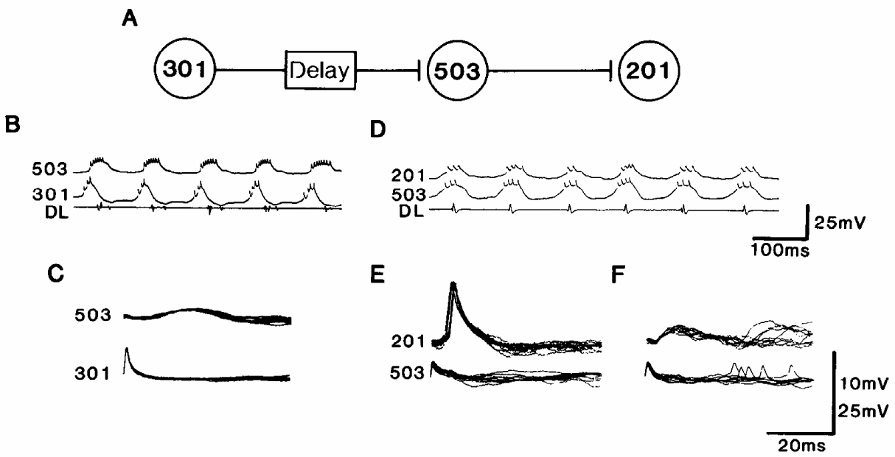
Interneuron chains carry CPG timing to depressor output
A premotor interneuron influences motor neurons, placing it between network timing and muscle activation. Robertson and Pearson found delayed excitation from 301 to interneuron 503, followed by excitation from 503 to 201. The 201 cells provide excitatory input to depressor motor neurons.
Paired intracellular recordings linked 301 spikes to delayed 503 responses and 503 spikes to shorter-latency 201 responses. The two stages preserve a separation between elevator-associated activity in 301 and later depressor-associated drive. Their recordings include millivolt voltage and millisecond time calibrations.
Robertson & Pearson (1985), Fig. 13. Recorded interactions among 301, 503 and 201.
The chain supplies a physiological route by which central activity can establish phase relationships in motor output. Two delayed stages between 301 activity and depressor drive account for the constant latency between elevator and depressor depolarizations and the steady depressor burst duration.
Wilson (1961), Fig. 1. Published dissection identifies ganglia, nerves and muscles.
Robertson & Pearson (1985); Wilson (1961)
29
Notes:
Teaching transcript:
A premotor interneuron influences motor neurons, placing it between network timing and muscle activation. Robertson and Pearson found delayed excitation from 301 to interneuron 503, followed by excitation from 503 to 201. The 201 cells provide excitatory input to depressor motor neurons.
Paired intracellular recordings linked 301 spikes to delayed 503 responses and 503 spikes to shorter-latency 201 responses. The two stages preserve a separation between elevator-associated activity in 301 and later depressor-associated drive. Their recordings include millivolt voltage and millisecond time calibrations.
The chain supplies a physiological route by which central activity can establish phase relationships in motor output. It is part of a broader network, with additional excitation and inhibition. The recorded connections do not establish that the chain is the only route to every depressor motor neuron.
The published circuit interpretation links delayed activation to the relatively stable elevator-to-depressor interval. Premotor cells can also participate in resetting the rhythm, so pattern generation and motor-output functions are not always exclusive cell categories.
References:
R. M. Robertson; K. G. Pearson (1985). Neural circuits in the flight system of the locust. Journal of Neurophysiology 53(1):110–128. https://doi.org/10.1152/jn.1985.53.1.110
D. M. Wilson (1961). The central nervous control of flight in a locust. Journal of Experimental Biology 38(2):471–490. https://doi.org/10.1242/jeb.38.2.471
Robertson & Pearson (1985), Fig. 13. Recorded interactions among 301, 503 and 201.
Figure source: https://doi.org/10.1152/jn.1985.53.1.110
Wilson (1961), Fig. 1. Published dissection identifies ganglia, nerves and muscles.
Figure source: https://doi.org/10.1242/jeb.38.2.471

Slide 39
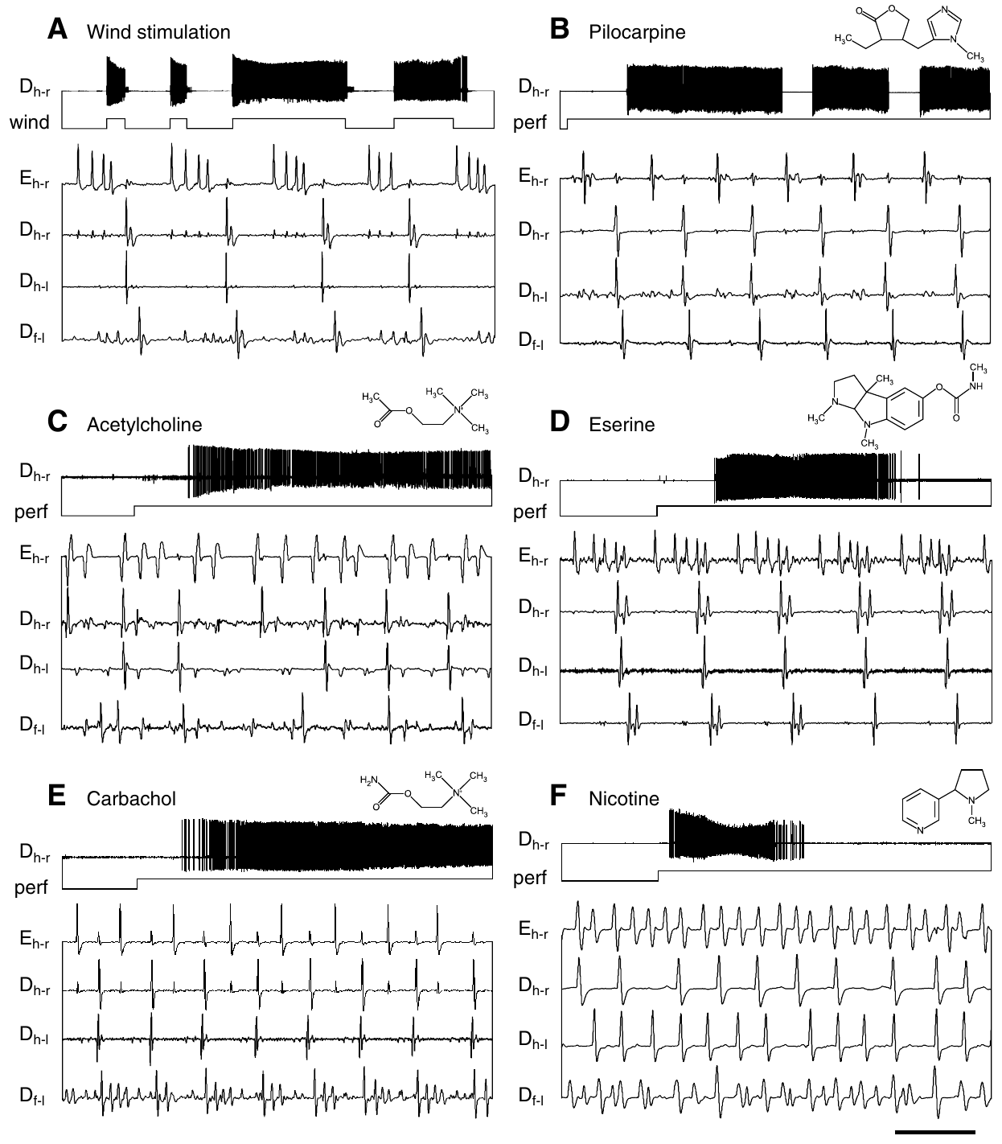
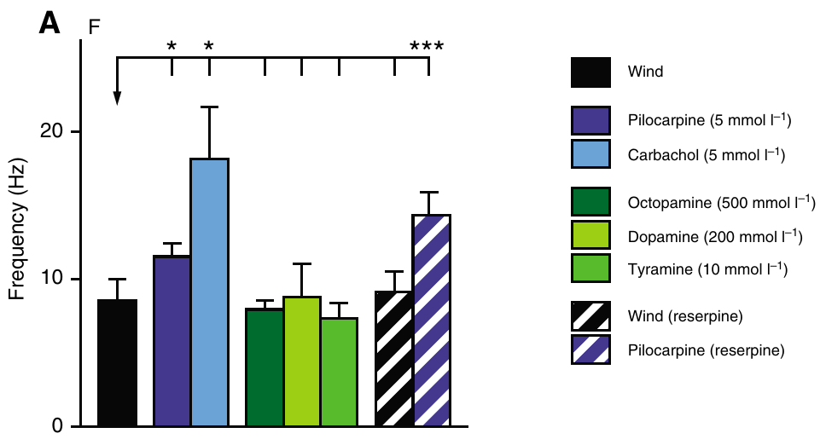
Muscarinic stimulation recruits a flight-like motor score
Acetylcholine is a neurotransmitter acting through nicotinic and muscarinic receptors. Muscarinic receptors are G-protein-coupled receptors that alter cellular signaling and excitability. An agonist activates a receptor; pilocarpine is a muscarinic agonist used to test flight activation.
Buhl and colleagues applied 5 mM pilocarpine to deafferented Schistocerca gregaria while recording hindwing elevators and depressors and bilateral wing-related muscles. Pilocarpine induced alternating activity after several seconds, with pauses interrupting the flight episodes. Wind-induced activity served as the reference pattern.
The agonist establishes that muscarinic stimulation can recruit the flight circuitry without phasic wing feedback. Eserine, which blocks acetylcholinesterase and so prolongs the action of the animal’s own acetylcholine, also initiated fictive flight. The retained muscle arrangement and phase relationships distinguish a flight score from general hyperactivity.
Buhl et al. (2008), Fig. 2(A). Frequencies of wind- and drug-induced flight patterns.
Buhl et al. (2008), Fig. 1(A–F). Wind- and pilocarpine-induced flight muscle activity.
Buhl et al. (2008)
30
Notes:
Teaching transcript:
Acetylcholine is a neurotransmitter acting through nicotinic and muscarinic receptors. Muscarinic receptors are G-protein-coupled receptors that alter cellular signaling and excitability. An agonist activates a receptor; pilocarpine is a muscarinic agonist used to test flight activation.
Buhl and colleagues applied 5 mM pilocarpine to deafferented Schistocerca gregaria while recording hindwing elevators and depressors and bilateral wing-related muscles. Pilocarpine induced alternating activity after several seconds, with pauses interrupting the flight episodes. Wind-induced activity served as the reference pattern.
The agonist establishes that muscarinic stimulation can recruit the flight circuitry without phasic wing feedback. Bath sufficiency does not identify the endogenous releasing neuron, local transmitter concentration, or receptor subtype. The retained muscle arrangement and phase relationships distinguish a flight score from general hyperactivity.
The thoracic sensory nerves were severed while motor innervation to the recorded muscles was retained. The reported bath dose was millimolar; it should not be interpreted as a measured synaptic acetylcholine concentration.
References:
E. Buhl; K. Schildberger; P. A. Stevenson (2008). A muscarinic cholinergic mechanism underlies activation of the central pattern generator for locust flight. Journal of Experimental Biology 211(14):2346–2357. https://doi.org/10.1242/jeb.017384
Buhl et al. (2008), Fig. 1(A–F). Wind- and pilocarpine-induced flight muscle activity.
Figure source: https://doi.org/10.1242/jeb.017384
Buhl et al. (2008), Fig. 2(A). Frequencies of wind- and drug-induced flight patterns.
Figure source: https://doi.org/10.1242/jeb.017384

Slide 40
Nicotinic excitation alone does not recruit stable flight
Nicotinic receptors are ligand-gated ion channels activated by acetylcholine and nicotine. Unlike muscarinic receptors, they mediate direct channel responses. Buhl and colleagues compared nicotine with carbachol, an acetylcholine analogue that activates both receptor classes.
At 1 mM, nicotine produced a brief burst of uncoordinated motor activity rather than a stable flight pattern. At 5 mM, carbachol produced sustained flight-like alternation near 18 Hz. This was faster than the approximately 11.5 Hz rhythm induced by pilocarpine in the same study.
Brief, uncoordinated motor activity under nicotine marks direct excitation of motor pathways, whereas a stable alternating score marks CPG recruitment. Carbachol’s faster rhythm compared with pilocarpine fits combined muscarinic and nicotinic actions adding drive to a circuit already recruited through muscarinic receptors.
Buhl et al. (2008), Fig. 2(A). Different activation treatments produce different rhythm frequencies.
Buhl et al. (2008), Fig. 1(A–F). Carbachol and nicotine produce different motor responses.
Buhl et al. (2008)
31
Notes:
Teaching transcript:
Nicotinic receptors are ligand-gated ion channels activated by acetylcholine and nicotine. Unlike muscarinic receptors, they mediate direct channel responses. Buhl and colleagues compared nicotine with carbachol, an acetylcholine analogue that activates both receptor classes.
At 1 mM, nicotine produced a brief burst of uncoordinated motor activity rather than a stable flight pattern. At 5 mM, carbachol produced sustained flight-like alternation near 18 Hz. This was faster than the approximately 11.5 Hz rhythm induced by pilocarpine in the same study.
Direct excitation of motor activity is therefore insufficient evidence for CPG recruitment. Combined muscarinic and nicotinic actions may support faster output, but the experiment did not isolate every cellular contribution. The nicotinic antagonist tests were not selectively reversible at doses that abolished activity.
A ligand is a molecule that binds a receptor. The study supports muscarinic activation and a possible additional nicotinic contribution to sustained high-frequency output. It did not measure channel currents in identified CPG cells.
References:
E. Buhl; K. Schildberger; P. A. Stevenson (2008). A muscarinic cholinergic mechanism underlies activation of the central pattern generator for locust flight. Journal of Experimental Biology 211(14):2346–2357. https://doi.org/10.1242/jeb.017384
Buhl et al. (2008), Fig. 1(A–F). Carbachol and nicotine produce different motor responses.
Figure source: https://doi.org/10.1242/jeb.017384
Buhl et al. (2008), Fig. 2(A). Different activation treatments produce different rhythm frequencies.
Figure source: https://doi.org/10.1242/jeb.017384

Slide 41
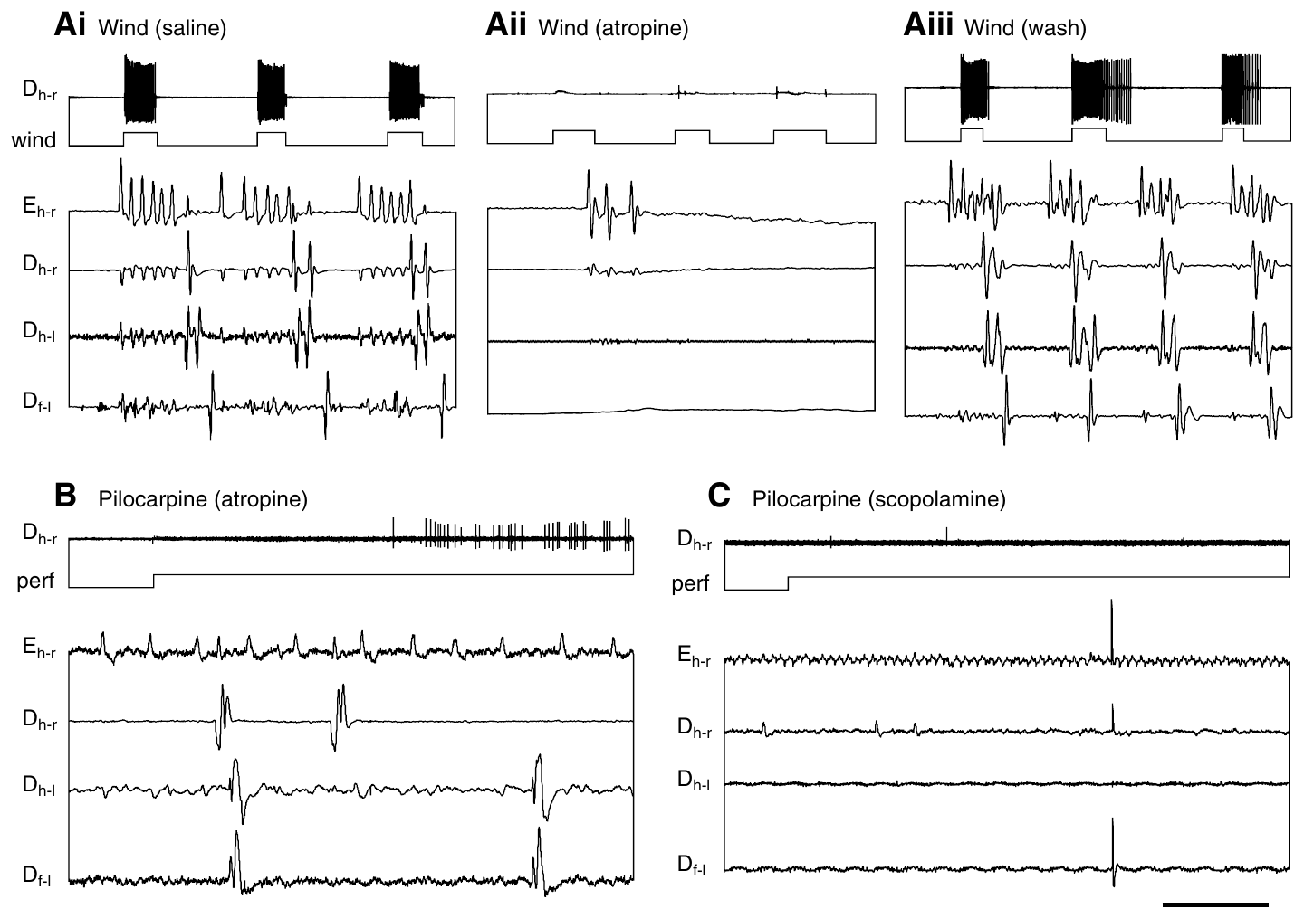
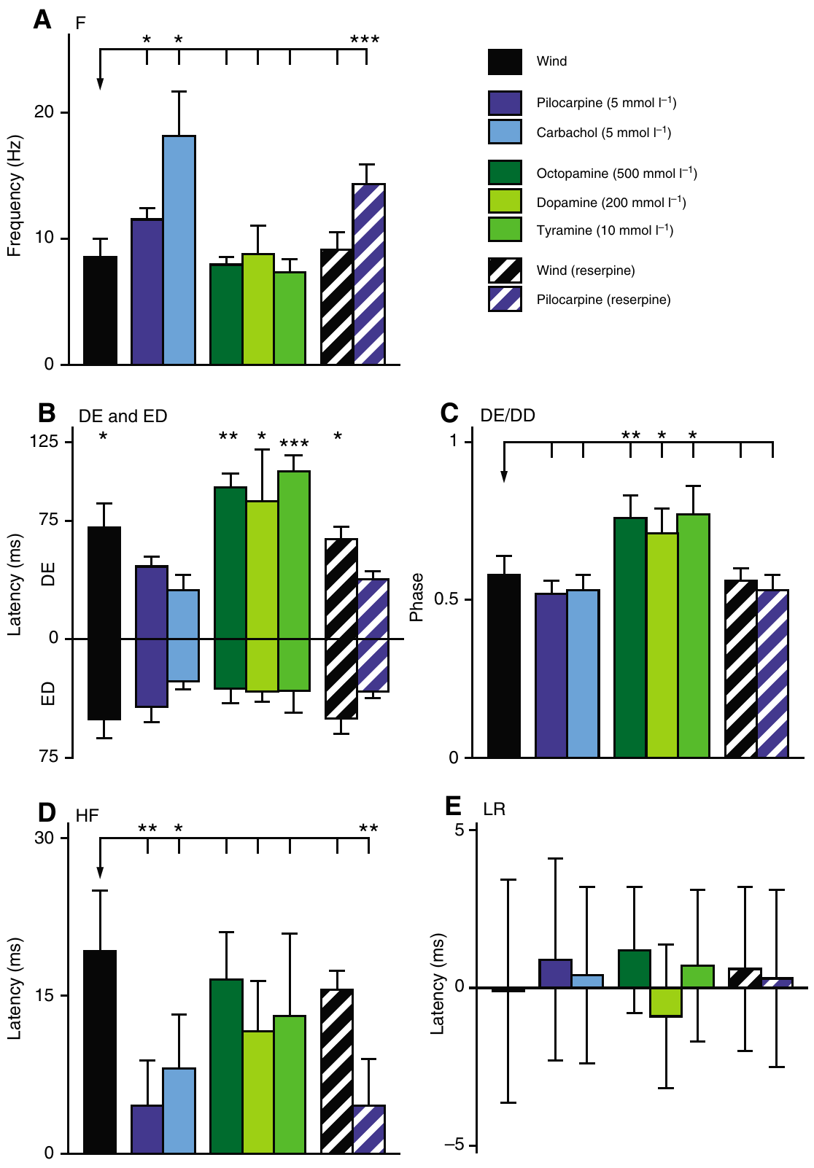
Muscarinic antagonists reversibly block wind initiation
An antagonist reduces a receptor’s response to its activating ligand. Buhl and colleagues perfused the thoracic nervous system with 10 mM atropine or scopolamine, both muscarinic antagonists. Wind stimulation and pilocarpine were tested during the treatment.
Wind normally evoked alternating elevator and depressor activity. During atropine perfusion, even strong wind failed to release a flight episode; saline wash restored the response after approximately 20 min. Atropine and scopolamine also blocked the flight-inducing action of pilocarpine.
Buhl et al. (2008), Fig. 3. Wind and pilocarpine responses during muscarinic blockade.
Reversibility reduces an explanation based solely on irreversible tissue damage. Blockade of natural stimulation and an agonist supports a necessary muscarinic step in the tested pathway. Agreement between two structurally different antagonists ties the block to the receptor class they share.
Buhl et al. (2008), Fig. 2. Motor-pattern measurements for the different activation conditions.
Buhl et al. (2008)
32
Notes:
Teaching transcript:
An antagonist reduces a receptor’s response to its activating ligand. Buhl and colleagues perfused the thoracic nervous system with 10 mM atropine or scopolamine, both muscarinic antagonists. Wind stimulation and pilocarpine were tested during the treatment.
Wind normally evoked alternating elevator and depressor activity. During atropine perfusion, even strong wind failed to release a flight episode; saline wash restored the response after approximately 20 min. Atropine and scopolamine also blocked the flight-inducing action of pilocarpine.
Reversibility reduces an explanation based solely on irreversible tissue damage. Blockade of natural stimulation and an agonist supports a necessary muscarinic step in the tested pathway. High bath doses and the absence of cell-specific receptor manipulation limit assignment of the affected receptor to a particular interneuron.
The head-wind pathway remained connected, whereas phasic wing sensory inputs were removed. The experiment therefore tests a central pharmacological requirement for sensory-evoked activation, rather than requiring normal wing motion to assess the drug.
References:
E. Buhl; K. Schildberger; P. A. Stevenson (2008). A muscarinic cholinergic mechanism underlies activation of the central pattern generator for locust flight. Journal of Experimental Biology 211(14):2346–2357. https://doi.org/10.1242/jeb.017384
Buhl et al. (2008), Fig. 3. Wind and pilocarpine responses during muscarinic blockade.
Figure source: https://doi.org/10.1242/jeb.017384
Buhl et al. (2008), Fig. 2. Motor-pattern measurements for the different activation conditions.
Figure source: https://doi.org/10.1242/jeb.017384

Slide 42
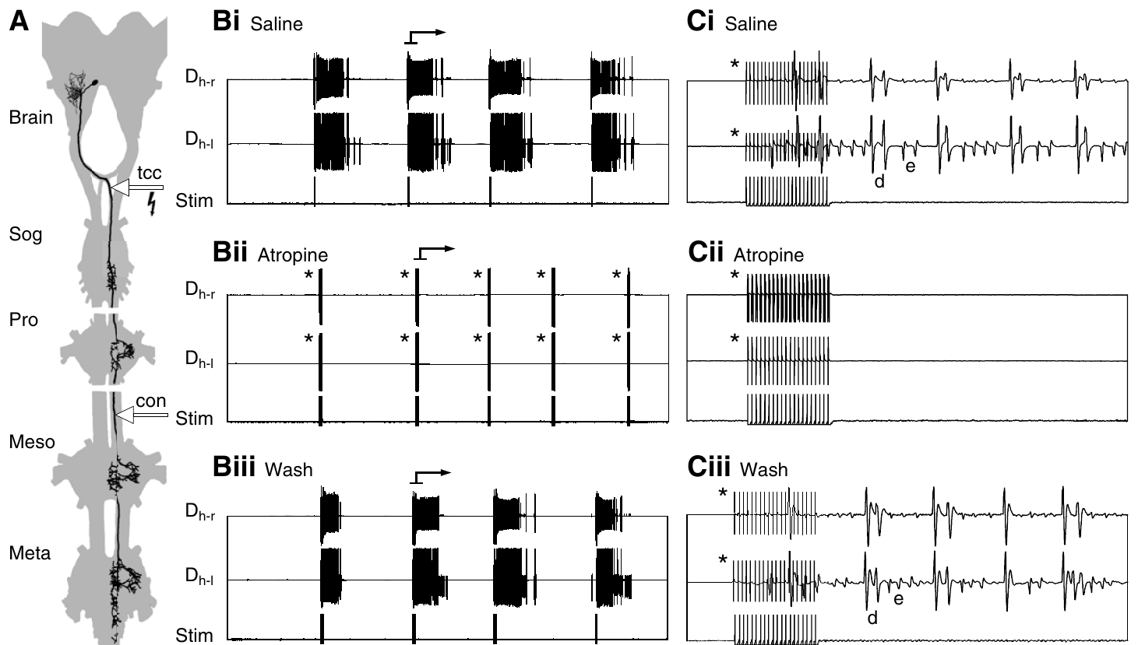
TCG-driven flight also requires muscarinic signaling
The tritocerebral commissure giant interneuron, or TCG, is a descending wind-responsive neuron with an axon approximately 20 μm in diameter. A commissure connects structures across the nervous system’s midline. Buhl and colleagues stimulated its accessible axon while monitoring flight muscle activity.
A train of 20 pulses at 200 Hz could evoke several seconds of fictive flight. The shortest onset delay was approximately 23 ms. Thoracic atropine blocked this response, and a saline wash restored it after approximately 30 min.
The short latency and reversible block support a muscarinic step close to the flight-generating circuit. TCG, or the follower cell it excites inside the flight-generating circuit, is therefore likely cholinergic. The experiment established a receptor-dependent route from an identified activating neuron to motor output.
Buhl et al. (2008), Fig. 4. TCG stimulation, atropine blockade and wash recovery.
Buhl et al. (2008)
33
Notes:
Teaching transcript:
The tritocerebral commissure giant interneuron, or TCG, is a descending wind-responsive neuron with an axon approximately 20 μm in diameter. A commissure connects structures across the nervous system’s midline. Buhl and colleagues stimulated its accessible axon while monitoring flight muscle activity.
A train of 20 pulses at 200 Hz could evoke several seconds of fictive flight. The shortest onset delay was approximately 23 ms. Thoracic atropine blocked this response, and a saline wash restored it after approximately 30 min.
The short latency and reversible block support a muscarinic step close to the flight-generating circuit. They do not prove that TCG itself releases acetylcholine: its follower neuron could supply the cholinergic action. The experiment established a receptor-dependent route from an identified activating neuron to motor output.
Stimulation was set at the threshold for the larger TCG axon to reduce recruitment of the smaller tritocerebral dwarf neuron. The first muscle burst involved elevators, followed by sustained elevator-depressor alternation.
References:
E. Buhl; K. Schildberger; P. A. Stevenson (2008). A muscarinic cholinergic mechanism underlies activation of the central pattern generator for locust flight. Journal of Experimental Biology 211(14):2346–2357. https://doi.org/10.1242/jeb.017384
Buhl et al. (2008), Fig. 4. TCG stimulation, atropine blockade and wash recovery.
Figure source: https://doi.org/10.1242/jeb.017384

Slide 43
A brief command can launch seconds of flight
Acetylcholine acts through two receptor classes with different time courses. A nicotinic receptor is itself a channel and opens within milliseconds while transmitter is bound; a muscarinic receptor activates G proteins that alter other channels through intracellular steps, so its effects build and decay more slowly.
A slow, outlasting effect suits flight activation. A train of 20 TCG pulses, over in a fraction of a second, evoked several seconds of fictive flight, so the command leaves an excited network state that persists after its own spikes stop, and atropine sensitivity places that state at muscarinic receptors.
The same timing distinction fits the drug results. Nicotine’s brief, uncoordinated burst resembles a fast channel response that subsides quickly, whereas muscarinic agonists produced stable alternation that persisted while the network supplied the rhythm.
Buhl et al. (2008), Fig. 4. TCG stimulation, atropine blockade and wash recovery.
Buhl et al. (2008)
33a
Notes:
Slides 30, 31 and 33 identify a muscarinic step in flight activation. The time course of muscarinic signaling helps explain why a short burst of command activity can be followed by a long flight episode.
Two receptor classes.
Ionotropic receptors such as the nicotinic type open a pore directly, so their current tracks the presence of transmitter closely.
Metabotropic receptors such as the muscarinic type act through G proteins and second messengers, and their effects can last well beyond the transmitter pulse.
A short command and a long episode.
The TCG stimulus lasted only as long as twenty pulses at two hundred per second, yet flight continued for seconds.
That persistence is consistent with a slow excitatory state in the flight network, and Buhl and colleagues found that atropine blocked the response reversibly.
Matching the drug responses.
Nicotine gave a short burst of uncoordinated motor activity, as expected from fast direct excitation without recruitment of the generator.
Muscarinic agonists instead produced sustained flight, with the cycle-by-cycle timing coming from the network’s own synaptic interactions.
References:
E. Buhl; K. Schildberger; P. A. Stevenson (2008). A muscarinic cholinergic mechanism underlies activation of the central pattern generator for locust flight. Journal of Experimental Biology 211(14):2346–2357. https://doi.org/10.1242/jeb.017384

Slide 44
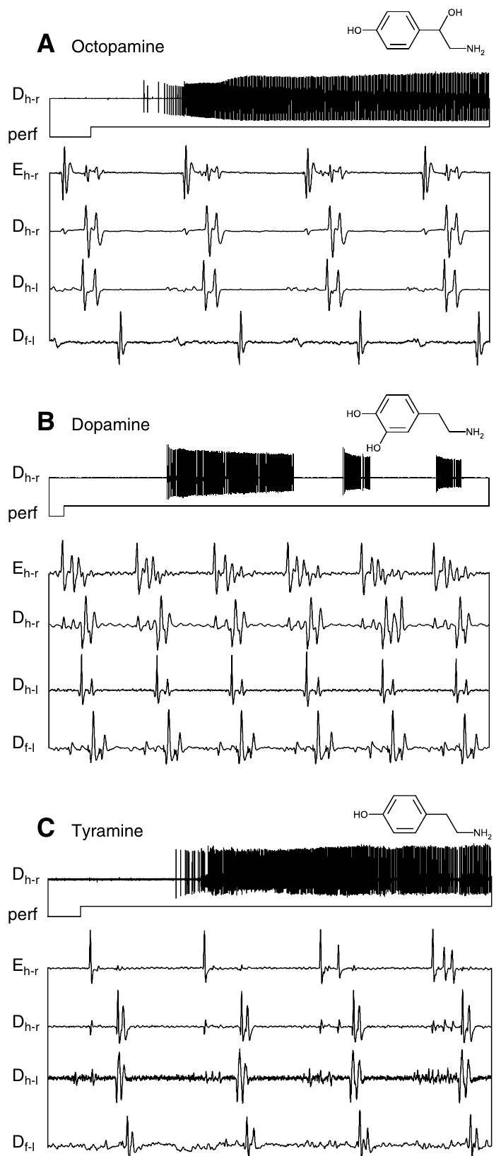
Amine-induced flight depends on muscarinic signaling
Biogenic amines are signaling molecules that can modulate neural activity; octopamine, dopamine and tyramine are examples. Buhl and colleagues applied them to deafferented preparations and compared their motor patterns with wind- and cholinergic-induced activity.
Octopamine at 500 mM and tyramine at 10 mM induced flight-like bursts under these bath conditions. Dopamine and histamine also released episodes, whereas serotonin and the precursor amino acid tyrosine did not. Atropine blocked the flight-inducing action of octopamine.
The antagonist result places muscarinic action downstream of, or within, the amine-recruited activation route. A flight network that responds to so many amines fits a system in which several modulators can raise excitability, while the activating step itself remains cholinergic.
Buhl et al. (2008), Fig. 2. Amine-induced patterns differ from cholinergic patterns in phase.
Buhl et al. (2008), Fig. 5(A–C). Octopamine and tyramine induce flight-related muscle bursts.
Buhl et al. (2008)
34
Notes:
Teaching transcript:
Biogenic amines are signaling molecules that can modulate neural activity; octopamine, dopamine and tyramine are examples. Buhl and colleagues applied them to deafferented preparations and compared their motor patterns with wind- and cholinergic-induced activity.
Octopamine at 500 mM and tyramine at 10 mM induced flight-like bursts under these bath conditions. Dopamine and histamine also released episodes, whereas serotonin and the precursor amino acid tyrosine did not. Atropine blocked the flight-inducing action of octopamine.
Drug-induced sufficiency does not establish an amine as the indispensable natural trigger. The antagonist result places muscarinic action downstream of, or within, the amine-recruited activation route. Bath drug potency cannot be equated with natural release probability or concentration at receptors behind the insect blood–brain barrier.
The large concentrations are those printed in the original 2008 article and are preserved as experimental bath concentrations. The doses in the later 2013 preparation were different; neither study measured the concentration reaching individual central receptors.
References:
E. Buhl; K. Schildberger; P. A. Stevenson (2008). A muscarinic cholinergic mechanism underlies activation of the central pattern generator for locust flight. Journal of Experimental Biology 211(14):2346–2357. https://doi.org/10.1242/jeb.017384
Buhl et al. (2008), Fig. 5(A–C). Octopamine and tyramine induce flight-related muscle bursts.
Figure source: https://doi.org/10.1242/jeb.017384
Buhl et al. (2008), Fig. 2. Amine-induced patterns differ from cholinergic patterns in phase.
Figure source: https://doi.org/10.1242/jeb.017384

Slide 45
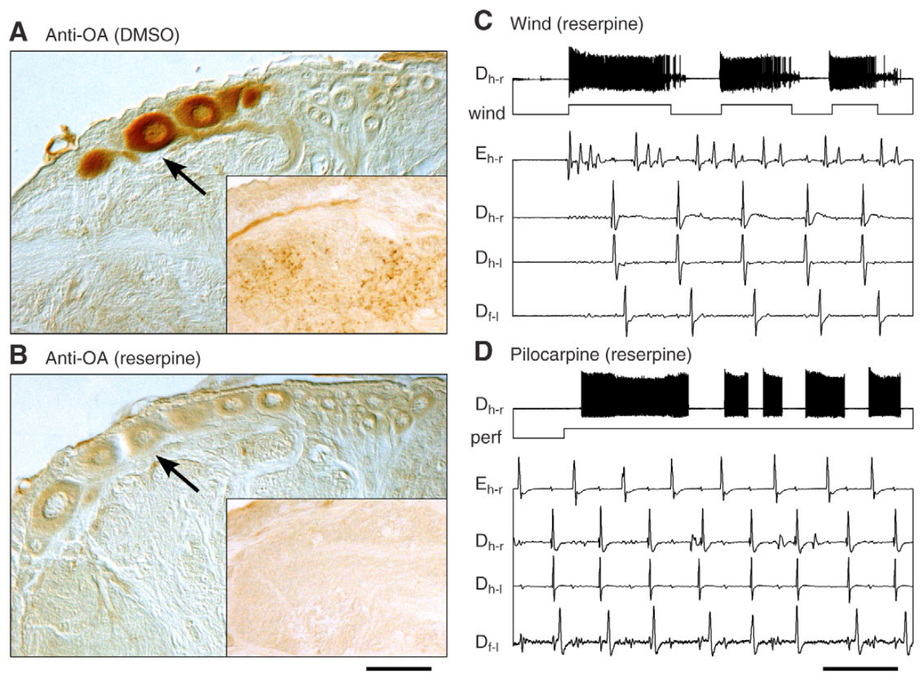
Flight initiation persists after verified amine depletion
Reserpine reduces stored biogenic amines and provides a test distinct from receptor-antagonist application. Buhl and colleagues injected a total of 500 μg per locust over two treatments. They examined thoracic tissue using octopamine immunocytochemistry, an antibody-based method for detecting octopamine-like labeling.
Control tissue labeled dorsal unpaired median neurons and fine processes in the flight neuropil. Reserpine-treated tissue lost this labeling. Nevertheless, wind and 5 mM pilocarpine still evoked flight-like activity with the main timing relationships retained.
The verified loss of labeling strengthens the conclusion that normal amine stores are not required for initiation in this preparation. Reserpine also emptied the DUM neurons supplying the flight neuropil, the only identified candidates for aminergic modulation of the flight circuit.
Buhl et al. (2008), Fig. 6. Octopamine staining and flight output after reserpine.
Buhl et al. (2008)
35
Notes:
Teaching transcript:
Reserpine reduces stored biogenic amines and provides a test distinct from receptor-antagonist application. Buhl and colleagues injected a total of 500 μg per locust over two treatments. They examined thoracic tissue using octopamine immunocytochemistry, an antibody-based method for detecting octopamine-like labeling.
Control tissue labeled dorsal unpaired median neurons and fine processes in the flight neuropil. Reserpine-treated tissue lost this labeling. Nevertheless, wind and 5 mM pilocarpine still evoked flight-like activity with the main timing relationships retained.
The verified loss of labeling strengthens the conclusion that normal amine stores are not required for initiation in this preparation. It does not prove that amines never affect intact flight, or exclude every residual molecule. Muscarinic activation remains distinguishable from aminergic facilitation and motor-pattern tuning.
Neuropil is tissue rich in interacting axons, dendrites and synapses. The treated animals were less active overall, yet the reduced preparation retained a releasable flight program. Reduced general activity and inability to activate a particular program are different outcomes.
References:
E. Buhl; K. Schildberger; P. A. Stevenson (2008). A muscarinic cholinergic mechanism underlies activation of the central pattern generator for locust flight. Journal of Experimental Biology 211(14):2346–2357. https://doi.org/10.1242/jeb.017384
Buhl et al. (2008), Fig. 6. Octopamine staining and flight output after reserpine.
Figure source: https://doi.org/10.1242/jeb.017384

Slide 46
Three drug tests separate activation from modulation
Pharmacology answers different questions depending on the test. An agonist asks whether stimulating a receptor can produce flight, an antagonist asks whether natural activation passes through that receptor, and depletion asks whether the transmitter itself must be present.
Amines passed only the first test: octopamine, tyramine, dopamine and histamine released flight in the bath, yet aminergic antagonists did not reversibly block wind-induced flight, and reserpine-treated locusts still flew. Muscarinic signaling passed the second test for wind, pilocarpine, amines and TCG alike.
Relying on agonists alone would have named octopamine the flight trigger. The combined results give amines a modulatory role, raising wind effectiveness and tightening leg-wing coupling at lower doses, and give acetylcholine at muscarinic receptors the activating role.
Buhl et al. (2008), Fig. 6. Octopamine staining and flight output after reserpine.
Buhl et al. (2008); Rillich et al. (2013)
35a
Notes:
Slides 30 to 35 use agonists, antagonists and depletion on the same flight preparation. The three methods test different claims, and only their combination assigns roles to acetylcholine and the amines.
What each test can show.
An agonist establishes only that a receptor can drive the circuit when flooded with drug, which says nothing about whether natural activation uses it.
An antagonist tests whether natural activation passes through the receptor, and depletion tests whether the endogenous transmitter must be available.
How the two transmitter systems scored.
Buhl and colleagues found that several amines started flight in the bath, but aminergic antagonists did not reversibly block initiation and amine-depleted animals still flew to wind.
Atropine and scopolamine, in contrast, reversibly blocked flight evoked by wind, cholinergic agonists, octopamine and TCG stimulation.
A modulatory role for amines.
Rillich and colleagues found that a lower octopamine dose raised the probability that wind released flight and tightened coupling between leg and wing units.
Earlier work had credited octopamine with activating the flight generator; the combined tests move that role to acetylcholine acting at muscarinic receptors.
References:
E. Buhl; K. Schildberger; P. A. Stevenson (2008). A muscarinic cholinergic mechanism underlies activation of the central pattern generator for locust flight. Journal of Experimental Biology 211(14):2346–2357. https://doi.org/10.1242/jeb.017384
J. Rillich; P. A. Stevenson; H.-J. Pflueger (2013). Flight and walking in locusts–cholinergic co-activation, temporal coupling and its modulation by biogenic amines. PLOS ONE 8(5):e62899. https://doi.org/10.1371/journal.pone.0062899

Slide 47
Activation chemistry changes frequency and phase together
Buhl and colleagues quantified the motor score with simultaneous recordings from a hindwing elevator and several depressor muscles. Cycle frequency is the number of complete repetitions per second; phase expresses where one event falls within that repetition.
Wind-induced fictive flight averaged approximately 8.6 Hz, pilocarpine-induced activity 11.5 Hz, and carbachol-induced activity 18.1 Hz. The elevator occupied phase approximately 0.58 with wind and 0.52 with pilocarpine, but approximately 0.76 during octopamine-induced activity.
Similar alternating patterns therefore need not have identical temporal structure. The chemistry used to release a motor program can also tune the program. Octopamine moved elevator activity later in the cycle, so an aminergic state can change how each wingbeat is divided between downstroke and upstroke.
Buhl et al. (2008), Fig. 2. Measured rhythm frequency, delays and phase across treatments.
Buhl et al. (2008)
36
Notes:
Teaching transcript:
Buhl and colleagues quantified the motor score with simultaneous recordings from a hindwing elevator and several depressor muscles. Cycle frequency is the number of complete repetitions per second; phase expresses where one event falls within that repetition.
Wind-induced fictive flight averaged approximately 8.6 Hz, pilocarpine-induced activity 11.5 Hz, and carbachol-induced activity 18.1 Hz. The elevator occupied phase approximately 0.58 with wind and 0.52 with pilocarpine, but approximately 0.76 during octopamine-induced activity.
Similar alternating patterns therefore need not have identical temporal structure. The chemistry used to release a motor program can also tune the program. These values describe deafferented preparations and should not be treated as interchangeable with the frequency, forces or wing angles of intact flight.
Left and right homologous muscles remained nearly synchronous across treatments, and corresponding forewing activity generally lagged hindwing activity. The comparison separates conserved organizational relationships from parameters that change with activation state.
References:
E. Buhl; K. Schildberger; P. A. Stevenson (2008). A muscarinic cholinergic mechanism underlies activation of the central pattern generator for locust flight. Journal of Experimental Biology 211(14):2346–2357. https://doi.org/10.1242/jeb.017384
Buhl et al. (2008), Fig. 2. Measured rhythm frequency, delays and phase across treatments.
Figure source: https://doi.org/10.1242/jeb.017384

Slide 48
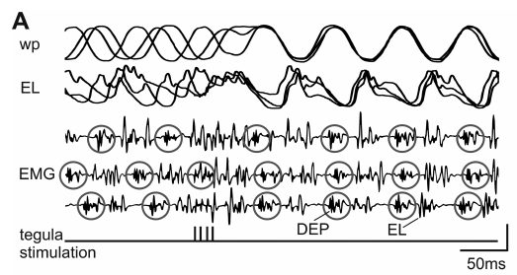
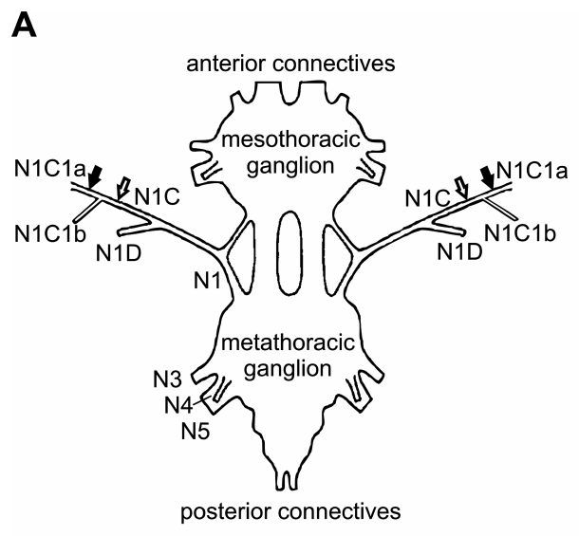
Tegula input resets the transition to wing elevation
The tegula is a proprioceptive sense organ at the wing base that signals wing downstroke. Proprioception supplies information about the animal’s own movement. Ausborn and colleagues electrically stimulated hindwing tegula afferents while monitoring wing position and elevator motor-neuron voltage.
Stimulus trains used 0.1 ms pulses at 220 Hz to approximate natural receptor bursts. Stimulating at different phases synchronized the subsequent elevator response and wing movement. Excitatory postsynaptic potential amplitudes varied within a flight episode even when stimulation occurred at similar phases.
Ausborn et al. (2007), Fig. 2(A). Wing motion and elevator recordings during tegula stimulation.
The tegula can therefore reset a centrally generated rhythm instead of merely reporting its movement. The response depends on circuit state and effective sensory input. Signaling each downstroke, the tegula excites elevator motor neurons and so triggers the upstroke at a time tied to actual wing position.
Ausborn et al. (2007), Fig. 1(A). Published ganglion and tegula-nerve recording preparation.
Ausborn et al. (2007)
37
Notes:
Teaching transcript:
The tegula is a proprioceptive sense organ at the wing base that signals wing downstroke. Proprioception supplies information about the animal’s own movement. Ausborn and colleagues electrically stimulated hindwing tegula afferents while monitoring wing position and elevator motor-neuron voltage.
Stimulus trains used 0.1 ms pulses at 220 Hz to approximate natural receptor bursts. Stimulating at different phases synchronized the subsequent elevator response and wing movement. Excitatory postsynaptic potential amplitudes varied within a flight episode even when stimulation occurred at similar phases.
The tegula can therefore reset a centrally generated rhythm instead of merely reporting its movement. The response depends on circuit state and effective sensory input. Electrical activation substitutes for natural hair movement, so it does not reproduce every mechanical detail of the intact wing-base receptor.
Open-loop stimulation is imposed without adapting each stimulus to the immediately preceding motor cycle. The later closed-loop experiment makes sensory stimulation depend on motor output, restoring an important reciprocal relationship.
References:
J. Ausborn; W. Stein; H. Wolf (2007). Frequency control of motor patterning by negative sensory feedback. Journal of Neuroscience 27(35):9319–9328. https://doi.org/10.1523/JNEUROSCI.0907-07.2007
Ausborn et al. (2007), Fig. 2(A). Wing motion and elevator recordings during tegula stimulation.
Figure source: https://doi.org/10.1523/JNEUROSCI.0907-07.2007
Ausborn et al. (2007), Fig. 1(A). Published ganglion and tegula-nerve recording preparation.
Figure source: https://doi.org/10.1523/JNEUROSCI.0907-07.2007

Slide 49
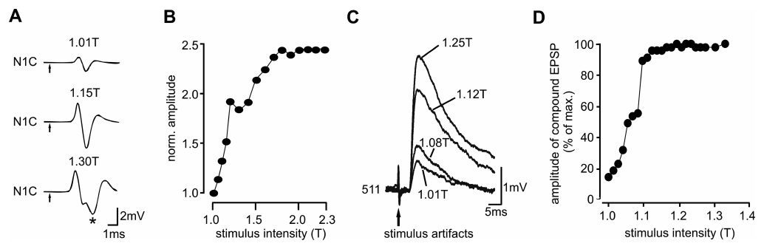
Recruiting more tegula afferents increases central input
Ausborn and colleagues stimulated the cut tegula nerve while recording its compound action potential, the summed extracellular response of several axons. The lowest stimulus voltage producing a detectable response defined threshold T. Increasing voltage recruited additional afferents.
A second nerve-response component appeared near 1.3 times threshold in the published example. Higher stimulus intensities also produced larger postsynaptic responses in flight interneurons, including 511. The recordings distinguish increasing peripheral recruitment from an assumed change in one neuron’s spike size.
Ausborn et al. (2007), Fig. 5. Recorded compound nerve responses and interneuron potentials.
Stimulus strength is therefore an experimentally controlled way to change the sensory drive reaching the network. Larger stimuli recruit more afferents, mimicking a stronger natural signal from more tegula receptors, and in closed loop that strength can be varied while timing stays locked to each depressor burst.
Ausborn et al. (2007), Fig. 1(A). Published ganglion and tegula-nerve recording preparation.
Ausborn et al. (2007)
38
Notes:
Teaching transcript:
Ausborn and colleagues stimulated the cut tegula nerve while recording its compound action potential, the summed extracellular response of several axons. The lowest stimulus voltage producing a detectable response defined threshold T. Increasing voltage recruited additional afferents.
A second nerve-response component appeared near 1.3 times threshold in the published example. Higher stimulus intensities also produced larger postsynaptic responses in flight interneurons, including 511. The recordings distinguish increasing peripheral recruitment from an assumed change in one neuron’s spike size.
Stimulus strength is therefore an experimentally controlled way to change the sensory drive reaching the network. It is not a direct measurement of natural synaptic gain at one identified receptor connection. The resulting network response must also be assessed with feedback timing allowed to depend on motor output.
Individual action potentials are not normally enlarged in proportion to stimulus voltage. The compound signal grows because more axons contribute, and its timing can change when slower-conducting fibers are recruited.
References:
J. Ausborn; W. Stein; H. Wolf (2007). Frequency control of motor patterning by negative sensory feedback. Journal of Neuroscience 27(35):9319–9328. https://doi.org/10.1523/JNEUROSCI.0907-07.2007
Ausborn et al. (2007), Fig. 5. Recorded compound nerve responses and interneuron potentials.
Figure source: https://doi.org/10.1523/JNEUROSCI.0907-07.2007
Ausborn et al. (2007), Fig. 1(A). Published ganglion and tegula-nerve recording preparation.
Figure source: https://doi.org/10.1523/JNEUROSCI.0907-07.2007

Slide 50
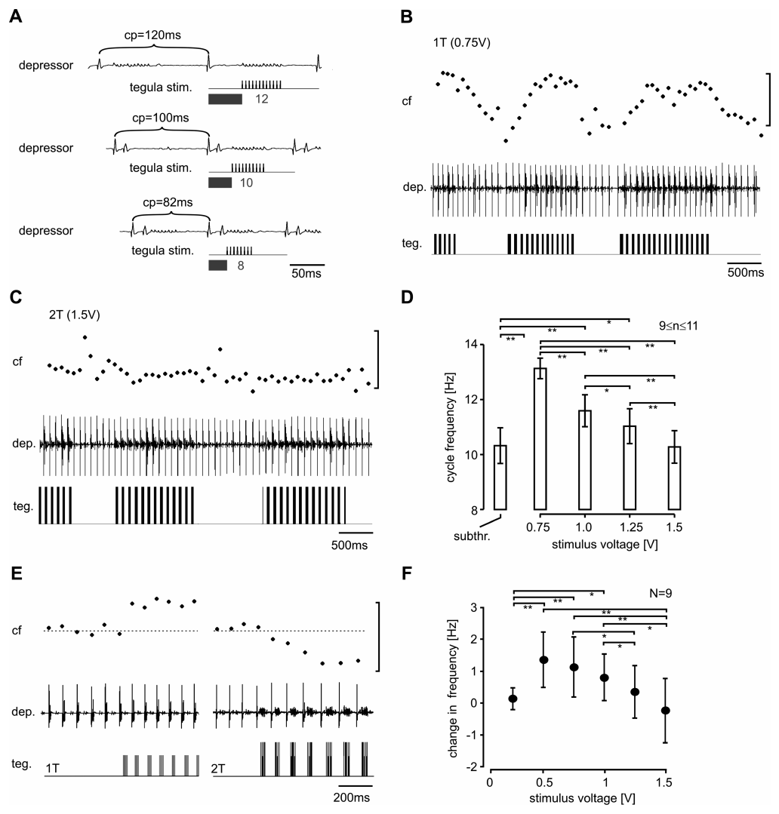
Closed-loop feedback strength can slow the flight rhythm
In closed-loop feedback, motor output affects the next sensory input, which then affects later motor output. Ausborn and colleagues used depressor muscle bursts to calculate the onset and duration of each subsequent tegula stimulus train in real time.
Near threshold, feedback sped the rhythm from approximately 10.3 to 13.1 Hz in the published example. Raising stimulation from 0.75 V to 1.5 V, twice threshold, greatly reduced that acceleration. In some preparations strong feedback slowed the rhythm below its unstimulated frequency.
Stronger sensory excitation does not therefore guarantee a faster closed-loop rhythm. Timing, stimulus duration and network inhibition interact across cycles. A computational model of the flight system predicted this relation, and feedback strength set cycle frequency in both the model and the animal.
Ausborn et al. (2007), Fig. 1(A). Published ganglion and tegula-nerve recording preparation.
Ausborn et al. (2007), Fig. 6(A–F). Biological flight output during dynamically timed tegula stimulation.
Ausborn et al. (2007)
39
Notes:
Teaching transcript:
In closed-loop feedback, motor output affects the next sensory input, which then affects later motor output. Ausborn and colleagues used depressor muscle bursts to calculate the onset and duration of each subsequent tegula stimulus train in real time.
Near threshold, feedback sped the rhythm from approximately 10.3 to 13.1 Hz in the published example. Raising stimulation from 0.75 V to 1.5 V, twice threshold, greatly reduced that acceleration. In some preparations strong feedback slowed the rhythm below its unstimulated frequency.
Stronger sensory excitation does not therefore guarantee a faster closed-loop rhythm. Timing, stimulus duration and network inhibition interact across cycles. The experimental recordings confirm a feedback-dependent relationship predicted by a model, but they do not establish every ionic current assumed by that model.
The illustrated recordings are from the biological locust preparation, not replotted data or simulated voltage traces. Increasing input can prolong the network state that delays the next depressor burst, changing the overall frequency despite excitation of elevator-related pathways.
References:
J. Ausborn; W. Stein; H. Wolf (2007). Frequency control of motor patterning by negative sensory feedback. Journal of Neuroscience 27(35):9319–9328. https://doi.org/10.1523/JNEUROSCI.0907-07.2007
Ausborn et al. (2007), Fig. 6(A–F). Biological flight output during dynamically timed tegula stimulation.
Figure source: https://doi.org/10.1523/JNEUROSCI.0907-07.2007
Ausborn et al. (2007), Fig. 1(A). Published ganglion and tegula-nerve recording preparation.
Figure source: https://doi.org/10.1523/JNEUROSCI.0907-07.2007

Slide 51
Stronger negative feedback lengthens each cycle
Negative feedback is a loop in which an output generates a signal that opposes further change in that output. The tegula fires during the downstroke, and its input pushes the network toward elevation, ending the phase that produced it.
Weak feedback arriving at the right moment hastens the switch to elevation, which shortens the cycle and raises frequency. Stronger trains last longer and recruit more afferents, so their excitation spills into the following phase, where inhibition within the network holds off the depressor motor neurons longer.
Ausborn et al. (2007), Fig. 2(A). Wing motion and elevator recordings during tegula stimulation.
Each stimulus train was timed from the depressor burst, so a later depressor burst also postpones the following feedback and carries the delay into every later cycle. The loop therefore settles at lower frequencies as feedback strength rises, a property expected of negative feedback in general.
Ausborn et al. (2007), Fig. 1(A). Published ganglion and tegula-nerve recording preparation.
Ausborn et al. (2007)
39a
Notes:
Slides 37 to 39 move from open-loop resetting to closed-loop control of frequency. The concept of negative feedback explains how one sensory loop can both speed and slow the rhythm.
The loop.
Wing depression activates the tegula, and the tegula signal promotes the switch to elevation.
Ausborn and colleagues describe this as negative feedback, since the sensory signal opposes continuation of the movement that caused it.
Weak versus strong feedback.
A small, well-timed input advances the transition and so shortens each cycle, which is why frequency rose near threshold.
With more afferents recruited and longer trains, excitation reaches parts of the network whose inhibitory actions postpone the downstroke burst.
Why the effect accumulates.
In closed loop, the timing of each stimulus depends on the preceding depressor burst, so a delay is passed on from cycle to cycle.
The authors found the same relation in their model and in the animal: stronger tegula feedback gave lower cycle frequency, and they suggest this is a general emergent property of negative feedback systems.
References:
J. Ausborn; W. Stein; H. Wolf (2007). Frequency control of motor patterning by negative sensory feedback. Journal of Neuroscience 27(35):9319–9328. https://doi.org/10.1523/JNEUROSCI.0907-07.2007

Slide 52
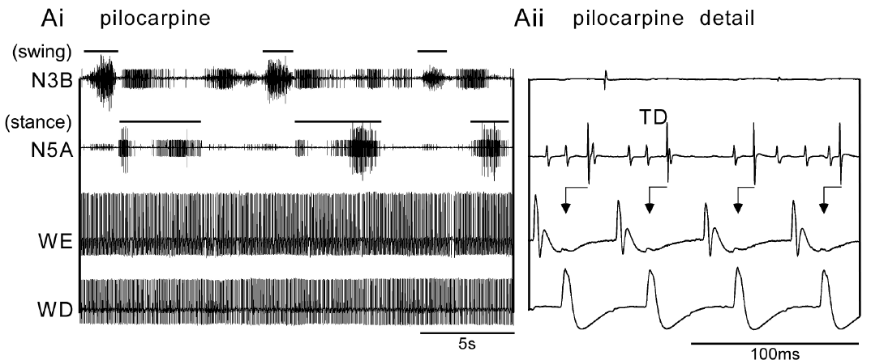
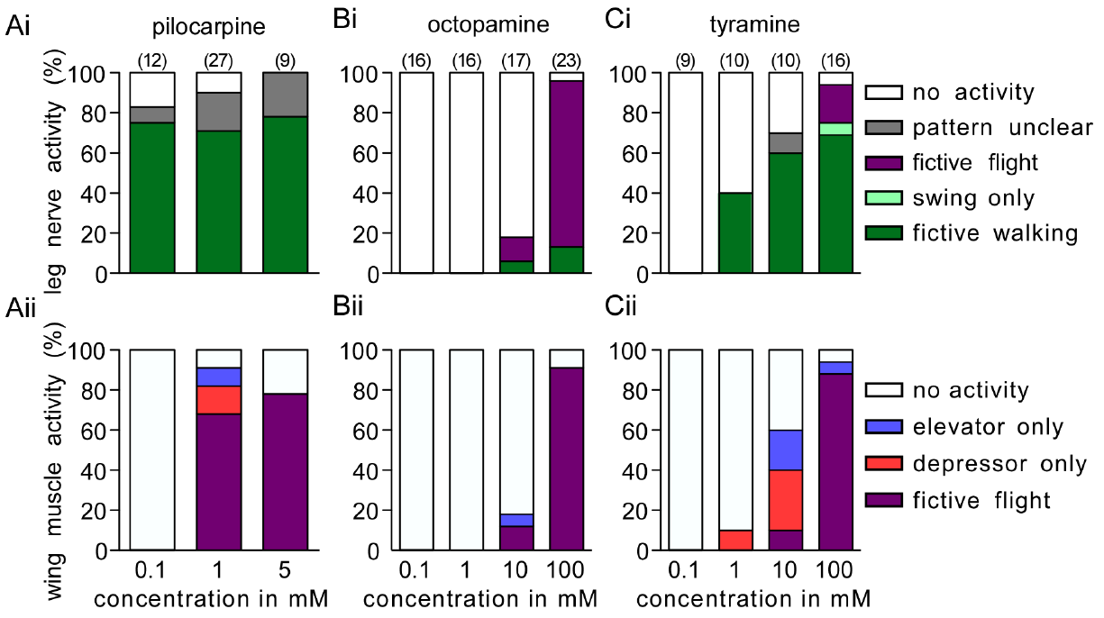
Walking and flight circuits can operate simultaneously
Rillich and colleagues recorded leg motor nerves and wing muscle activity from the same deafferented locust. Co-activation means that two motor programs are expressed together. The preparation retained motor output but removed sensory and descending inputs that ordinarily help select locomotion.
At 1 mM pilocarpine, slow walking-like bursts in leg pathways could occur at the same time as rapid flight-like wing alternation. Walking activity often began within approximately 1 min of drug application and flight activity followed after approximately 1–3 min. Individual leg spikes could become coupled to wingbeats within the slow step rhythm.
Rillich et al. (2013), Fig. 3(A). Simultaneous leg and wing output during pilocarpine exposure.
The two CPGs can therefore remain active concurrently in a reduced nervous system. Walking usually started first, and its swing-stance rhythm kept its basic timing after flight began. The flight circuit thus influences leg output, whereas walking left the flight rhythm unchanged.
Rillich et al. (2013), Fig. 4. Drug concentration changes the expressed leg and wing motor patterns.
Rillich et al. (2013)
40
Notes:
Teaching transcript:
Rillich and colleagues recorded leg motor nerves and wing muscle activity from the same deafferented locust. Co-activation means that two motor programs are expressed together. The preparation retained motor output but removed sensory and descending inputs that ordinarily help select locomotion.
At 1 mM pilocarpine, slow walking-like bursts in leg pathways could occur at the same time as rapid flight-like wing alternation. Walking activity often began within approximately 1 min of drug application and flight activity followed after approximately 1–3 min. Individual leg spikes could become coupled to wingbeats within the slow step rhythm.
The two CPGs can therefore remain active concurrently in a reduced nervous system. This does not mean that intact locusts normally walk and fly simultaneously. Behavioral exclusivity can depend on additional selection mechanisms rather than obligatory inhibition between the core rhythm generators.
The slow leg pattern and rapid flight pattern occupy different time scales. Temporal coupling of individual spikes can occur without eliminating the longer swing-stance organization of the leg output.
References:
J. Rillich; P. A. Stevenson; H.-J. Pflueger (2013). Flight and walking in locusts–cholinergic co-activation, temporal coupling and its modulation by biogenic amines. PLOS ONE 8(5):e62899. https://doi.org/10.1371/journal.pone.0062899
Rillich et al. (2013), Fig. 3(A). Simultaneous leg and wing output during pilocarpine exposure.
Figure source: https://doi.org/10.1371/journal.pone.0062899
Rillich et al. (2013), Fig. 4. Drug concentration changes the expressed leg and wing motor patterns.
Figure source: https://doi.org/10.1371/journal.pone.0062899

Slide 53

Octopamine and tyramine recruit different motor states
Rillich and colleagues compared octopamine with tyramine, its biosynthetic precursor and an independent signaling molecule. Both could activate flight-related output, but their effects on leg motor patterns differed. The same preparation and recorded pathways were used for the comparison.
Octopamine at 100 mM strongly recruited flight-like wing activity and usually coupled leg motor units to the flight rhythm. Tyramine at 10 mM could recruit walking-like activity; a higher 100 mM concentration could recruit flight as well. Leg-wing coupling was weaker during tyramine-induced activity.
Rillich et al. (2013), Fig. 3(B,C). Leg and wing activity under octopamine versus tyramine.
The effect of an amine therefore includes which motor state becomes available and how outputs are coordinated. Tyramine favors walking and octopamine favors flight with leg units recruited into the flight score, consistent with the two amines acting as independent signals through dedicated receptors.
Rillich et al. (2013), Fig. 4. Concentration-dependent recruitment differs between the two amines.
Rillich et al. (2013)
41
Notes:
Teaching transcript:
Rillich and colleagues compared octopamine with tyramine, its biosynthetic precursor and an independent signaling molecule. Both could activate flight-related output, but their effects on leg motor patterns differed. The same preparation and recorded pathways were used for the comparison.
Octopamine at 100 mM strongly recruited flight-like wing activity and usually coupled leg motor units to the flight rhythm. Tyramine at 10 mM could recruit walking-like activity; a higher 100 mM concentration could recruit flight as well. Leg-wing coupling was weaker during tyramine-induced activity.
The effect of an amine therefore includes which motor state becomes available and how outputs are coordinated. Structural relatedness does not imply interchangeable physiological action. The experiment establishes responses to applied drugs rather than the timing of natural octopamine or tyramine release during flight choice.
Trochanteral levator and depressor units report opposing leg motor phases. Coupling means their spike timing becomes related to wing depressor activity; it does not imply that every recorded leg unit has acquired the same function.
References:
J. Rillich; P. A. Stevenson; H.-J. Pflueger (2013). Flight and walking in locusts–cholinergic co-activation, temporal coupling and its modulation by biogenic amines. PLOS ONE 8(5):e62899. https://doi.org/10.1371/journal.pone.0062899
Rillich et al. (2013), Fig. 3(B,C). Leg and wing activity under octopamine versus tyramine.
Figure source: https://doi.org/10.1371/journal.pone.0062899
Rillich et al. (2013), Fig. 4. Concentration-dependent recruitment differs between the two amines.
Figure source: https://doi.org/10.1371/journal.pone.0062899

Slide 54
Walking and flight are chosen upstream of their CPGs
Two behaviors can be mutually exclusive for two different reasons. Their pattern generators might inhibit each other, so that one running silences the other, or the generators might be independent and the choice made by which activating inputs reach them.
Co-activation in the deafferented locust favors the second explanation. A shared or mutually inhibitory kernel would force the two patterns to alternate, yet slow stepping and fast wing alternation ran side by side.
Rillich et al. (2013), Fig. 3(A). Simultaneous leg and wing output during pilocarpine exposure.
Selection must then occur in the pathways removed by deafferentation. Tarsal contact, which holds flight off in a standing locust, is one such pathway, and releasing stimuli such as head wind supply another, so the intact animal recruits one program by gating its activation.
Rillich et al. (2013), Fig. 4. Drug concentration changes the expressed leg and wing motor patterns.
Rillich et al. (2013); Camhi (1969c)
41a
Notes:
Slides 40 and 41 find walking and flight patterns running at the same time in one reduced nervous system. Comparing two ways of keeping behaviors exclusive explains what that finding implies for the intact animal.
Two candidate mechanisms.
If the generators inhibited each other, activating one would suppress the other, and the patterns would alternate rather than overlap.
If the generators are independent, exclusivity has to come from the inputs that switch each one on.
The co-activation test.
Rillich and colleagues saw no sign of mutual inhibition, such as alternating sequences of the two patterns, and the walking rhythm did not change when flight began.
They conclude that the activation pathways and core circuits of the two generators are functionally and anatomically separate.
Selection in the intact locust.
The authors point to sensory mechanisms such as the tarsal reflex, together with natural releasing stimuli, as the means of selecting one behavior.
Camhi’s finding that foot contact can inhibit flight on slide 6 is one such mechanism, and deafferentation removes it.
References:
J. Rillich; P. A. Stevenson; H.-J. Pflueger (2013). Flight and walking in locusts–cholinergic co-activation, temporal coupling and its modulation by biogenic amines. PLOS ONE 8(5):e62899. https://doi.org/10.1371/journal.pone.0062899
J. M. Camhi (1969c). Locust wind receptors. III. Contribution to flight initiation and lift control. Journal of Experimental Biology 50(2):363–373. https://doi.org/10.1242/jeb.50.2.363

Slide 55


Octopamine tunes leg-wing coupling during wind flight
Rillich and colleagues retained head input to release fictive flight with wind, then tested how amines changed motor coordination. Epinastine is an octopamine receptor antagonist. Leg and wing recordings separated effects on activation from effects on timing during ongoing episodes.
Bath-applied octopamine at 5 mM increased the effectiveness of wind and shortened the cycle. It also tightened the timing of leg motor units relative to wing depressor output, whereas 1 mM epinastine loosened that relationship. Tyramine and its antagonist had no comparable effect on coupling under the tested conditions.
Rillich et al. (2013), Fig. 11. Changes in motor coupling after amine and antagonist treatments.
These observations support octopaminergic modulation of recruitment and coordination. Facilitation and obligatory activation are different causal roles, so octopamine can raise wind effectiveness although amine-depleted locusts still initiate flight. Tighter coupling of a stance-phase leg unit to wingbeats may help steer or stabilize flight.
Rillich et al. (2013), Fig. 1(A–C). Published leg-nerve and wing-muscle recording anatomy.
Rillich et al. (2013)
42
Notes:
Teaching transcript:
Rillich and colleagues retained head input to release fictive flight with wind, then tested how amines changed motor coordination. Epinastine is an octopamine receptor antagonist. Leg and wing recordings separated effects on activation from effects on timing during ongoing episodes.
Bath-applied octopamine at 5 mM increased the effectiveness of wind and shortened the cycle. It also tightened the timing of leg motor units relative to wing depressor output, whereas 1 mM epinastine loosened that relationship. Tyramine and its antagonist had no comparable effect on coupling under the tested conditions.
These observations support octopaminergic modulation of recruitment and coordination. They do not contradict the persistence of initiation after amine depletion: facilitation and obligatory activation are different causal roles. The experiment did not directly localize the receptor responsible for coupling to a single CPG neuron.
The antagonist affected the temporal dispersion of leg-wing relationships more than the elevator-depressor relationship within the flight score. The result concerns coordination among outputs rather than identifying the source of the core flight rhythm.
References:
J. Rillich; P. A. Stevenson; H.-J. Pflueger (2013). Flight and walking in locusts–cholinergic co-activation, temporal coupling and its modulation by biogenic amines. PLOS ONE 8(5):e62899. https://doi.org/10.1371/journal.pone.0062899
Rillich et al. (2013), Fig. 11. Changes in motor coupling after amine and antagonist treatments.
Figure source: https://doi.org/10.1371/journal.pone.0062899
Rillich et al. (2013), Fig. 1(A–C). Published leg-nerve and wing-muscle recording anatomy.
Figure source: https://doi.org/10.1371/journal.pone.0062899

Slide 56


DUM neurons regulate metabolic readiness of flight muscle
Dorsal unpaired median neurons, or DUM neurons, are centrally located modulatory neurons with peripheral projections. Mentel and colleagues stimulated DUM axons supplying flight muscle M119 in Locusta migratoria. Their experiment separated modulatory input from the motor-neuron input that produces contraction.
After unilateral denervation, 1 Hz DUM stimulation for 20 min increased muscle fructose 2,6-bisphosphate, a regulator that promotes glycolysis. Its amount rose approximately sevenfold relative to the contralateral control muscle. Glycolysis is the pathway that supplies energy by breaking down carbohydrate.
Central modulatory neurons can therefore prepare the muscle’s metabolic state without themselves generating wingbeat contractions. The within-animal comparison supports a peripheral effect of DUM activity. Octopamine released from DUM terminals carries the signal, linking an amine that modulates central flight circuits to the muscle’s energy supply.
Buhl et al. (2008), Fig. 6(A,B). Octopamine-associated DUM cells in stained thoracic sections.
Mentel et al. (2003), Fig. 1. DUM stimulation and flight-muscle glycolytic activator levels.
Mentel et al. (2003); Buhl et al. (2008)
43
Notes:
Teaching transcript:
Dorsal unpaired median neurons, or DUM neurons, are centrally located modulatory neurons with peripheral projections. Mentel and colleagues stimulated DUM axons supplying flight muscle M119 in Locusta migratoria. Their experiment separated modulatory input from the motor-neuron input that produces contraction.
After unilateral denervation, 1 Hz DUM stimulation for 20 min increased muscle fructose 2,6-bisphosphate, a regulator that promotes glycolysis. Its amount rose approximately sevenfold relative to the contralateral control muscle. Glycolysis is the pathway that supplies energy by breaking down carbohydrate.
Central modulatory neurons can therefore prepare the muscle’s metabolic state without themselves generating wingbeat contractions. The within-animal comparison supports a peripheral effect of DUM activity. It does not establish that these neurons initiate the flight CPG or remain equally active throughout sustained flight.
The published thoracic tissue staining identifies octopamine-associated DUM cells, while the muscle study tests their peripheral metabolic action. A neuron’s transmitter and projection targets do not imply that it supplies rhythmic motor commands.
References:
T. Mentel; C. Duch; H. Stypa; G. Wegener; U. Müller; H.-J. Pflüger (2003). Central modulatory neurons control fuel selection in flight muscle of migratory locust. Journal of Neuroscience 23(4):1109–1113. https://doi.org/10.1523/JNEUROSCI.23-04-01109.2003
E. Buhl; K. Schildberger; P. A. Stevenson (2008). A muscarinic cholinergic mechanism underlies activation of the central pattern generator for locust flight. Journal of Experimental Biology 211(14):2346–2357. https://doi.org/10.1242/jeb.017384
Mentel et al. (2003), Fig. 1. DUM stimulation and flight-muscle glycolytic activator levels.
Figure source: https://doi.org/10.1523/JNEUROSCI.23-04-01109.2003
Buhl et al. (2008), Fig. 6(A,B). Octopamine-associated DUM cells in stained thoracic sections.
Figure source: https://doi.org/10.1242/jeb.017384

Slide 57

PKA is required but insufficient for the metabolic effect
Cyclic AMP, or cAMP, is an intracellular second messenger; protein kinase A, or PKA, is an enzyme activated by cAMP that modifies proteins through phosphorylation. Mentel and colleagues assayed PKA activity and the glycolytic regulator after DUM stimulation.
DUM activity increased PKA activity in flight muscle. Applying the PKA inhibitor KT5720 prevented the DUM-associated increase in fructose 2,6-bisphosphate. A cAMP donor increased PKA activity without reproducing the increase in the glycolytic regulator after a 20 min treatment.
PKA signaling is therefore necessary but not sufficient for the metabolic response, pointing to a second, parallel pathway, possibly calcium-dependent. Octopamine released by DUM neurons can thus act through more than one intracellular route to raise carbohydrate use in flight muscle.
Mentel et al. (2003), Fig. 1. DUM projections and the controlled flight-muscle preparation.
Mentel et al. (2003), Fig. 3. PKA blockade and cAMP-donor effects on the glycolytic regulator.
Mentel et al. (2003)
44
Notes:
Teaching transcript:
Cyclic AMP, or cAMP, is an intracellular second messenger; protein kinase A, or PKA, is an enzyme activated by cAMP that modifies proteins through phosphorylation. Mentel and colleagues assayed PKA activity and the glycolytic regulator after DUM stimulation.
DUM activity increased PKA activity in flight muscle. Applying the PKA inhibitor KT5720 prevented the DUM-associated increase in fructose 2,6-bisphosphate. A cAMP donor increased PKA activity without reproducing the increase in the glycolytic regulator after a 20 min treatment.
PKA signaling is therefore necessary under these test conditions but is insufficient by itself for the metabolic response. A parallel pathway, possibly involving calcium signaling, was proposed but not established. The experiment concerns muscle metabolism, and cannot be transferred directly to muscarinic activation of thoracic CPG neurons.
Phosphorylation is addition of a phosphate group to a protein. The inhibitor tests necessity, whereas the cAMP-donor experiment tests sufficiency. The two results support involvement of more than one signaling contribution.
References:
T. Mentel; C. Duch; H. Stypa; G. Wegener; U. Müller; H.-J. Pflüger (2003). Central modulatory neurons control fuel selection in flight muscle of migratory locust. Journal of Neuroscience 23(4):1109–1113. https://doi.org/10.1523/JNEUROSCI.23-04-01109.2003
Mentel et al. (2003), Fig. 3. PKA blockade and cAMP-donor effects on the glycolytic regulator.
Figure source: https://doi.org/10.1523/JNEUROSCI.23-04-01109.2003
Mentel et al. (2003), Fig. 1. DUM projections and the controlled flight-muscle preparation.
Figure source: https://doi.org/10.1523/JNEUROSCI.23-04-01109.2003

Slide 58
DUM neurons prime glycolysis before take-off
Fructose 2,6-bisphosphate activates phosphofructokinase, a rate-limiting enzyme of glycolysis, so raising it speeds carbohydrate breakdown in muscle. The DUM pathway reaches it in steps: octopamine binds muscle receptors, cAMP rises, PKA phosphorylates target proteins, and the regulator’s level climbs.
Timing makes this control useful. DUM neurons supplying flight muscle are active at rest but selectively inhibited during flight, so octopamine primes the muscle for the high carbohydrate demand of take-off and then declines once flight is under way.
Falling glycolytic activation during prolonged flight fits the locust’s shift toward lipid as its main fuel, which spares limited carbohydrate reserves on long flights. Central neurons thus set the muscle’s fuel choice according to behavioral state, while motor neurons drive contraction.
Mentel et al. (2003), Fig. 1. DUM projections and the controlled flight-muscle preparation.
Mentel et al. (2003), Fig. 3. PKA blockade and cAMP-donor effects on the glycolytic regulator.
Mentel et al. (2003)
44a
Notes:
Slides 43 and 44 show DUM stimulation raising a glycolytic regulator through PKA. The enzyme it acts on and the timing of DUM activity explain what this does for a flying locust.
From neuron to enzyme.
Fructose 2,6-bisphosphate is a potent allosteric activator of phosphofructokinase, which controls flux through glycolysis.
Mentel and colleagues found that PKA is necessary for the DUM effect, placing a cAMP-dependent step between octopamine release and the rise in the regulator.
Active at rest, silent in flight.
According to the authors, DUM neurons innervating the flight muscles fire during rest and are selectively inhibited during flight.
The muscle is therefore poised for carbohydrate use when flight begins, and that stimulation fades as flight continues.
Fuel switching.
Take-off requires high rates of carbohydrate oxidation, but locusts soon switch to lipid on long flights to spare limited carbohydrate.
Removing the octopaminergic drive during flight tends to lower muscle glycolysis, which fits that switch.
References:
T. Mentel; C. Duch; H. Stypa; G. Wegener; U. Müller; H.-J. Pflüger (2003). Central modulatory neurons control fuel selection in flight muscle of migratory locust. Journal of Neuroscience 23(4):1109–1113. https://doi.org/10.1523/JNEUROSCI.23-04-01109.2003

Slide 59
Central generation works with sensory control
Wilson’s reduced preparations established that wing motion is unnecessary for a basic central flight rhythm. Ausborn and colleagues tested how experimentally restored tegula input reshapes that rhythm when sensory stimulation depends on the preceding motor cycle.
The central output was slower and less normally organized without the peripheral loop. Feedback near threshold could accelerate the rhythm, while stronger closed-loop input diminished that acceleration or slowed it. Wind supplies activation, and wing-base sensors supply information about the movement that activation produces.
A CPG is therefore part of a sensorimotor system rather than a guarantee of normal movement in isolation. Wind hairs and 404 cells activate the network, muscarinic signaling sets its activated state, inhibitory interneuron loops pattern each cycle, and tegula feedback adjusts its frequency to the wing’s actual motion.
Ausborn et al. (2007), Fig. 1(A). Published ganglion and tegula-nerve recording preparation.
Ausborn et al. (2007), Fig. 6(A–F). Flight frequency changes with experimentally restored feedback.
Ausborn et al. (2007)
45
Notes:
Teaching transcript:
Wilson’s reduced preparations established that wing motion is unnecessary for a basic central flight rhythm. Ausborn and colleagues tested how experimentally restored tegula input reshapes that rhythm when sensory stimulation depends on the preceding motor cycle.
The central output was slower and less normally organized without the peripheral loop. Feedback near threshold could accelerate the rhythm, while stronger closed-loop input diminished that acceleration or slowed it. Wind supplies activation, and wing-base sensors supply information about the movement that activation produces.
A CPG is therefore part of a sensorimotor system rather than a guarantee of normal movement in isolation. Central drive, synaptic network interactions, receptor-dependent state and reciprocal feedback contribute different functions. The cited preparations establish those distinctions without providing a complete reconstruction of every connection required for intact flight.
The experimental evidence supports a distributed explanation: an activating pathway makes flight circuitry available, central interactions organize repetitive output, and sensory feedback modifies its timing. Removing one contribution tests that contribution without proving the others are irrelevant.
References:
J. Ausborn; W. Stein; H. Wolf (2007). Frequency control of motor patterning by negative sensory feedback. Journal of Neuroscience 27(35):9319–9328. https://doi.org/10.1523/JNEUROSCI.0907-07.2007
Ausborn et al. (2007), Fig. 6(A–F). Flight frequency changes with experimentally restored feedback.
Figure source: https://doi.org/10.1523/JNEUROSCI.0907-07.2007
Ausborn et al. (2007), Fig. 1(A). Published ganglion and tegula-nerve recording preparation.
Figure source: https://doi.org/10.1523/JNEUROSCI.0907-07.2007

Slide 60
Key takeaways
Central generation Thoracic circuits produce flight-like alternation without phasic wing feedback; intact frequency and control still depend on sensory interaction.
Wind coding Head hairs encode speed and direction jointly. Interneurons distinguish maintained airflow, direction, recentring and acceleration.
Activation versus rhythm Tonic 404 drive can release flight, whereas phase-dependent resetting implicates neurons such as 301 and 501 in rhythm generation.
Synaptic mechanism Delayed excitation can arise through disinhibition. Pharmacology and reversal tests support a mechanism without identifying every intermediate cell or channel.
Chemical state Muscarinic signaling supports flight initiation; amines facilitate recruitment, timing and coordination rather than constituting an obligatory trigger in the tested preparation.
Feedback and muscle readiness Closed-loop tegula input alters frequency, and DUM activity regulates muscle metabolism. Neither role replaces the central generator.
Wilson (1961); Camhi (1969a–c); Pearson et al. (1985); Robertson & Pearson (1985); Buhl et al. (2008); Ausborn et al. (2007); Rillich et al. (2013)
46
Notes:
Central generation. Thoracic circuits produce flight-like alternation without phasic wing feedback; intact frequency and control still depend on sensory interaction.
Wind coding. Head hairs encode speed and direction jointly. Interneurons distinguish maintained airflow, direction, recentring and acceleration.
Activation versus rhythm. Tonic 404 drive can release flight, whereas phase-dependent resetting implicates neurons such as 301 and 501 in rhythm generation.
Synaptic mechanism. Delayed excitation can arise through disinhibition. Pharmacology and reversal tests support a mechanism without identifying every intermediate cell or channel.
Chemical state. Muscarinic signaling supports flight initiation; amines facilitate recruitment, timing and coordination rather than constituting an obligatory trigger in the tested preparation.
Feedback and muscle readiness. Closed-loop tegula input alters frequency, and DUM activity regulates muscle metabolism. Neither role replaces the central generator.
References:
D. M. Wilson (1961). The central nervous control of flight in a locust. Journal of Experimental Biology 38(2):471–490. https://doi.org/10.1242/jeb.38.2.471
J. M. Camhi (1969a). Locust wind receptors. I. Transducer mechanics and sensory response. Journal of Experimental Biology 50(2):335–348. https://doi.org/10.1242/jeb.50.2.335
J. M. Camhi (1969b). Locust wind receptors. II. Interneurones in the cervical connective. Journal of Experimental Biology 50(2):349–362. https://doi.org/10.1242/jeb.50.2.349
J. M. Camhi (1969c). Locust wind receptors. III. Contribution to flight initiation and lift control. Journal of Experimental Biology 50(2):363–373. https://doi.org/10.1242/jeb.50.2.363
K. G. Pearson; D. N. Reye; D. W. Parsons; G. Bicker (1985). Flight-initiating interneurons in the locust. Journal of Neurophysiology 53(4):910–925. https://doi.org/10.1152/jn.1985.53.4.910
R. M. Robertson; K. G. Pearson (1985). Neural circuits in the flight system of the locust. Journal of Neurophysiology 53(1):110–128. https://doi.org/10.1152/jn.1985.53.1.110
E. Buhl; K. Schildberger; P. A. Stevenson (2008). A muscarinic cholinergic mechanism underlies activation of the central pattern generator for locust flight. Journal of Experimental Biology 211(14):2346–2357. https://doi.org/10.1242/jeb.017384
J. Ausborn; W. Stein; H. Wolf (2007). Frequency control of motor patterning by negative sensory feedback. Journal of Neuroscience 27(35):9319–9328. https://doi.org/10.1523/JNEUROSCI.0907-07.2007
J. Rillich; P. A. Stevenson; H.-J. Pflueger (2013). Flight and walking in locusts–cholinergic co-activation, temporal coupling and its modulation by biogenic amines. PLOS ONE 8(5):e62899. https://doi.org/10.1371/journal.pone.0062899
T. Mentel; C. Duch; H. Stypa; G. Wegener; U. Müller; H.-J. Pflüger (2003). Central modulatory neurons control fuel selection in flight muscle of migratory locust. Journal of Neuroscience 23(4):1109–1113. https://doi.org/10.1523/JNEUROSCI.23-04-01109.2003

