Slide 1
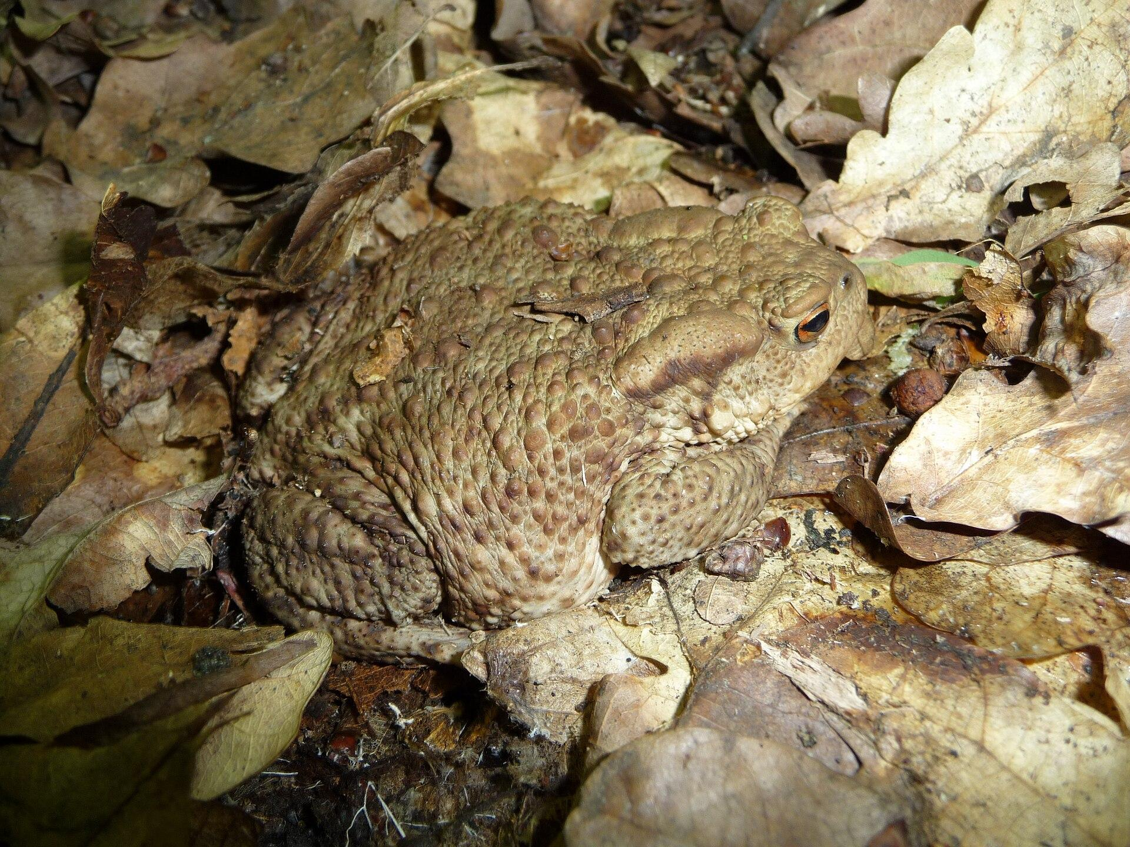
NEUR 411 · NEUROETHOLOGY · FALL 2026
Lecture 9
Amphibian prey capture I:
toad visual prey-catching and tectal feature detectors (Ewert)
Monday, September 14, 2026
Jordan Lopez, Ph.D.
Professor of Neurobiology & Biomedical Engineering
Photo: Common toad (Bufo bufo), the species used in Ewert's prey-catching studies.
Notes:
Amphibian prey capture I: toad visual prey-catching and tectal feature detectors (Ewert)
Lecture 9. NEUR 411 · NEUROETHOLOGY · FALL 2026. Monday, September 14, 2026.
Image: Photo: Common toad (Bufo bufo), the species used in Ewert's prey-catching studies. Credit: George Chernilevsky. License: Public domain. Source: https://commons.wikimedia.org/wiki/File:Bufo_bufo_2009_G1.jpg

Slide 2
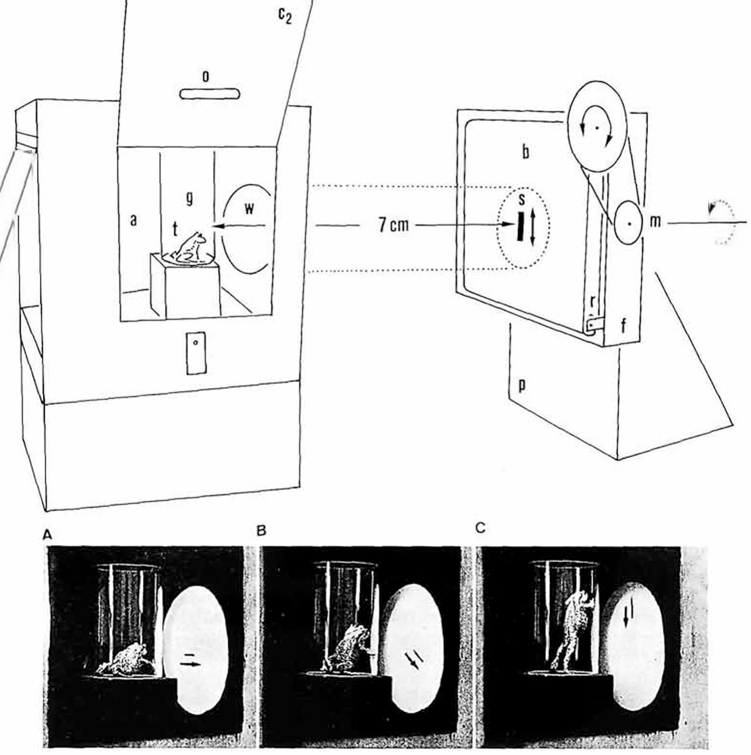
Common toads catch prey in a fixed sequence of acts
The common toad, Bufo bufo, is an active forager. Prey-catching proceeds as a sequence of acts: the toad orients (turns its head and body toward the object), approaches it, fixates it binocularly and finally snaps, flipping out its sticky tongue. Each act is ballistic, but the chain depends on where the prey moves.
Ewert's laboratory measured the first act under controlled conditions. A toad sat in a glass vessel while a small cardboard object was driven past a window at a fixed distance of about 7 cm, and an observer counted the toad's turning responses.
Frogs such as Rana esculenta hunt differently, as sit-and-wait predators that often orient and snap in one smooth event and accept non-prey items more readily.
Ewert et al. (1979), Fig. 1. Apparatus: a toad (t) in a glass vessel watches a stimulus (s) moved past a window; photos A–C show turning toward it.
Ewert et al. (2001); Ewert et al. (1979)
02
Notes:
• The common toad is an active hunter, and Ewert broke its prey-catching into a sequence of separate acts.
– First it orients, turning toward the object; then it approaches, fixates the object with both eyes, and finally snaps with its tongue.
– Each act is fast and ballistic, but which act comes next depends on where the prey is.
• To measure the behavior, a toad sat in a glass vessel and a small piece of black cardboard was moved past a window about 7 centimeters away.
– Counting how often the toad turned toward the object gives a number for how prey-like that object is.
• Frogs like Rana esculenta wait for prey instead, often turning and snapping in one movement, and they snap at non-prey items more often than toads.
References:
Ewert JP, Buxbaum-Conradi H, Dreisvogt F, Glagow M, Merkel-Harff C, Röttgen A, Schürg-Pfeiffer E, Schwippert WW (2001). Neural modulation of visuomotor functions underlying prey-catching behaviour in anurans: perception, attention, motor performance, learning. Comparative Biochemistry and Physiology A 128: 417–461. https://doi.org/10.1016/S1095-6433(00)00333-0
Ewert JP, Arend B, Becker V, Borchers HW (1979). Invariants in configurational prey selection by Bufo bufo (L.). Brain, Behavior and Evolution 16: 38–51. https://doi.org/10.1159/000121822
Figure: Ewert et al. (1979), Fig. 1. Apparatus: a toad (t) in a glass vessel watches a stimulus (s) moved past a window; photos A–C show turning toward it.
Figure source: https://doi.org/10.1159/000121822

Slide 3
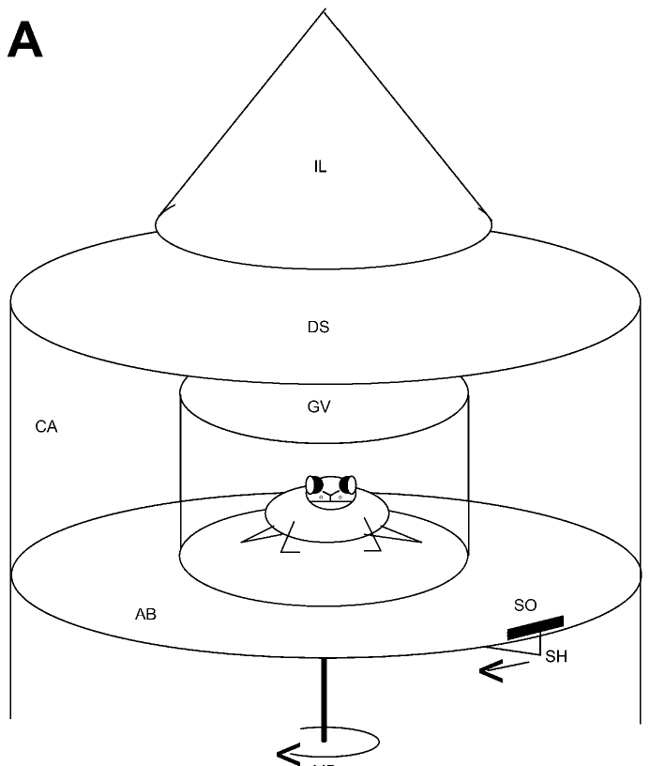
Turning toward a circling dummy measures prey value
In the standard dummy test, the toad sits in a glass vessel at the center of a cylindrical arena. A black cardboard object, the dummy, is moved around the vessel at constant angular velocity by a motor-driven holder.
Each time the object passes, a hungry toad turns to follow it. The number of orienting turns per 30 s is the measure of how strongly the stimulus releases prey-catching.
With shape, size, contrast and speed under the experimenter's control, the dummy test turns a natural behavior into a quantitative stimulus–response relationship. One turning score can then be set beside neuronal firing, lesion effects and learning, so worm and antiworm stripes served both as behavioral tests and as stimuli for single-cell recordings.
Ewert et al. (2001), Fig. 2A. Arena for the dummy test: the toad in a glass vessel (GV) and the stimulus object (SO) driven around it by a motor (MD).
Ewert et al. (2001)
03
Notes:
• In the standard test the toad sits in a glass vessel in the middle of a round arena, and a black cardboard object circles around it at a constant speed.
– A hungry toad turns to follow the object each time it passes.
• The number of turns in 30 seconds is the measure of how prey-like the stimulus is.
• The strength of this method is control.
– Shape, size, contrast and speed can each be changed one at a time, and the same number can then be compared with neuron recordings, lesions and learning experiments.
References:
Ewert JP, Buxbaum-Conradi H, Dreisvogt F, Glagow M, Merkel-Harff C, Röttgen A, Schürg-Pfeiffer E, Schwippert WW (2001). Neural modulation of visuomotor functions underlying prey-catching behaviour in anurans: perception, attention, motor performance, learning. Comparative Biochemistry and Physiology A 128: 417–461. https://doi.org/10.1016/S1095-6433(00)00333-0
Figure: Ewert et al. (2001), Fig. 2A. Arena for the dummy test: the toad in a glass vessel (GV) and the stimulus object (SO) driven around it by a motor (MD).
Figure source: https://doi.org/10.1016/S1095-6433(00)00333-0

Slide 4
Orienting gives a graded readout of prey value
A key stimulus is the small set of cues that triggers a behavior, and a releasing mechanism is the neural process that recognizes those cues and starts the act. Ewert asked which visual cues form the toad's key stimulus for prey.
A cardboard dummy answers by subtraction. It has no odor, texture or wriggling of its own, so any turning it releases depends on vision alone, and with speed and distance fixed, a change in turning can be assigned to the one dimension varied.
Orienting opens the catching sequence, so turning measures the earliest decision, whether an object counts as prey at all, before approach and snapping add their own requirements. Counting turns over a fixed interval gives a graded readout that ranks weak releasers against strong ones.
Ewert et al. (1979), Fig. 1. Apparatus: a toad (t) in a glass vessel watches a stimulus (s) moved past a window; photos A–C show turning toward it.
Ewert et al. (1979); Ewert (1997)
03a
Notes:
• The dummy paradigm rests on the ethological idea of a key stimulus, and its design choices each remove one alternative explanation for a change in turning.
• Key stimulus and releasing mechanism.
– Ewert framed his whole program around two questions: which features of an object release prey-catching, and which neurons evaluate them.
– His 1997 review uses exactly these terms, the key stimulus and the releasing mechanism, as the two concepts the toad work was meant to connect.
• What the dummy removes.
– A real mealworm smells, moves its own body and differs in texture, so a toad's response to it could rest on any of these cues.
– Slides 2 and 3 describe a black cardboard object moved by a motor at fixed distance and speed, which leaves only shape and motion to vary.
– On slide 4 that control allows the edge length along the path and the edge length across it to be changed one at a time.
• Why count turns.
– Orienting is the first act on slide 2, so it reflects recognition before the later acts of approach, fixation and snapping come into play.
– A count over a fixed time window yields a number that can rise or fall smoothly, which makes the later comparison with neuron classes on slide 11 possible.
References:
Ewert JP, Arend B, Becker V, Borchers HW (1979). Invariants in configurational prey selection by Bufo bufo (L.). Brain, Behavior and Evolution 16: 38–51. https://doi.org/10.1159/000121822
Ewert JP (1997). Neural correlates of key stimulus and releasing mechanism: a case study and two concepts. Trends in Neurosciences 20(8): 332–339. https://doi.org/10.1016/S0166-2236(96)01042-9

Slide 5
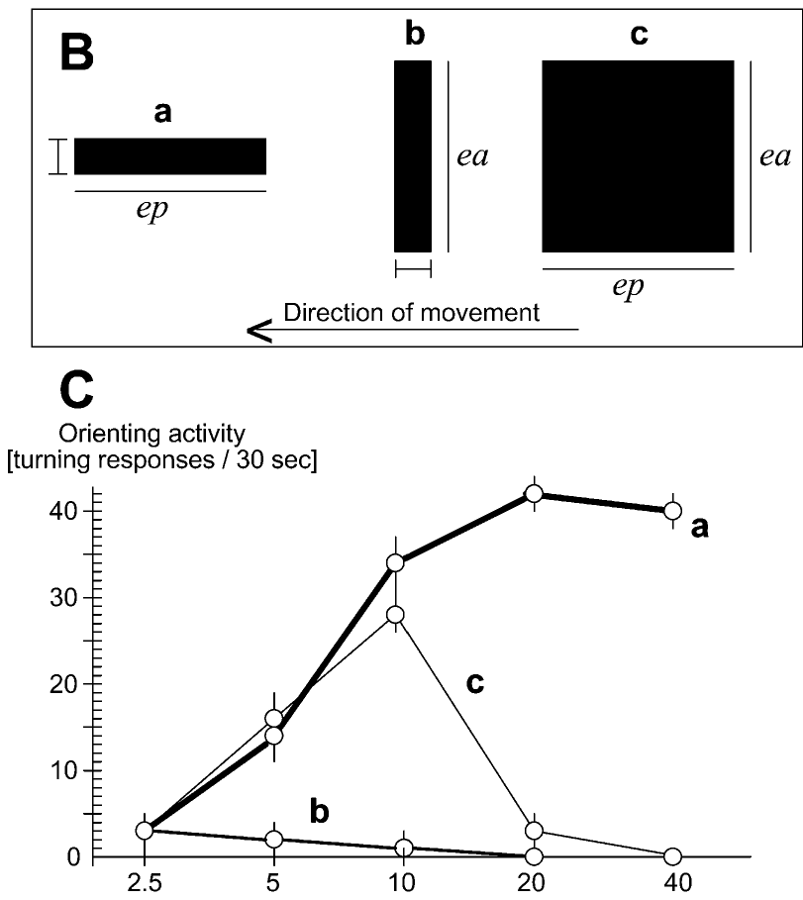
A worm is long along its direction of motion
Ewert varied two dimensions of a black rectangle. ep is its edge length parallel to the direction of movement and ea its edge length across the direction of movement.
Lengthening a 2.5-mm bar along ep, which produces a worm-like stripe, increased the turning rate steeply, to about 40 turns per 30 s at 20–40 mm. Lengthening the same bar along ea, an antiworm, abolished turning. Squares (ep = ea) became more effective up to about 10 mm and then lost their prey value as they grew larger.
The toad therefore does not respond to size alone. It relates the two extensions to each other, a computation Ewert called a features-relating algorithm: extension along ep signals prey, and extension along ea, the most decisive feature, reduces prey value. Large squares, which extend in both dimensions, resemble threats.
Ewert et al. (2001), Fig. 2B–C. Stimuli a (worm), b (antiworm) and c (square) and turning rate as each edge length increases (n = 20 toads).
Ewert et al. (2001); Ewert (1997)
04
Notes:
• Ewert used black rectangles and changed two dimensions separately.
– ep is the length along the direction of movement and ea is the length across it.
• The results were clear.
– Making a 2.5 millimeter bar longer along its direction of motion, a worm, raised the turning rate to about 40 turns per 30 seconds.
– Making the same bar longer across its direction of motion, an antiworm, abolished turning.
– Squares worked best around 10 millimeters and then stopped working as they grew.
• So the toad compares the two extensions instead of judging size.
– Length along the movement direction signals prey, length across it reduces prey value, and a large square that is big in both directions resembles a threat.
References:
Ewert JP, Buxbaum-Conradi H, Dreisvogt F, Glagow M, Merkel-Harff C, Röttgen A, Schürg-Pfeiffer E, Schwippert WW (2001). Neural modulation of visuomotor functions underlying prey-catching behaviour in anurans: perception, attention, motor performance, learning. Comparative Biochemistry and Physiology A 128: 417–461. https://doi.org/10.1016/S1095-6433(00)00333-0
Ewert JP (1997). Neural correlates of key stimulus and releasing mechanism: a case study and two concepts. Trends in Neurosciences 20(8): 332–339. https://doi.org/10.1016/S0166-2236(96)01042-9
Figure: Ewert et al. (2001), Fig. 2B–C. Stimuli a (worm), b (antiworm) and c (square) and turning rate as each edge length increases (n = 20 toads).
Figure source: https://doi.org/10.1016/S1095-6433(00)00333-0

Slide 6
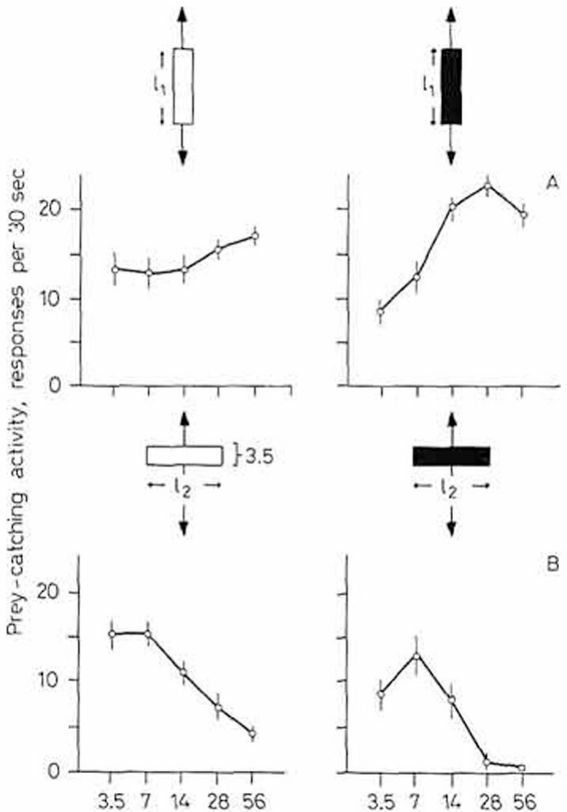
Worm preference holds for vertical motion and contrast
Ewert, Arend, Becker and Borchers asked whether the worm–antiworm distinction depends on how the stimulus moves. Stripes 3.5 mm wide were moved up and down in front of the toad at 16°/s.
When the stripe was elongated along its vertical path (worm), turning increased with length. When it was elongated perpendicular to its path (antiworm), turning decreased toward zero. The rule was the same as for horizontal motion: the axis that matters is defined by the direction of movement, not by gravity or the horizon.
The discrimination also held when white stripes moved on a black background, although black stripes on white produced stronger responses. Contrast direction therefore changes the overall level of prey-catching but not the configurational preference.
Ewert et al. (1979), Fig. 2. Turning to vertically moving stripes: worm-like (A) and antiworm-like (B), white on black (left) and black on white (right).
Ewert et al. (1979)
05
Notes:
• The next question was whether the worm rule depends on horizontal movement.
– Stripes were moved up and down in front of the toad instead of sideways.
• The answer was no.
– A stripe long along its vertical path was still a worm and drew more turning as it lengthened.
– A stripe long across its path was still an antiworm and was rejected.
• The same held for white stripes on a black background. Black on white gave stronger responses overall, but the worm–antiworm preference was the same.
References:
Ewert JP, Arend B, Becker V, Borchers HW (1979). Invariants in configurational prey selection by Bufo bufo (L.). Brain, Behavior and Evolution 16: 38–51. https://doi.org/10.1159/000121822
Figure: Ewert et al. (1979), Fig. 2. Turning to vertically moving stripes: worm-like (A) and antiworm-like (B), white on black (left) and black on white (right).
Figure source: https://doi.org/10.1159/000121822

Slide 7
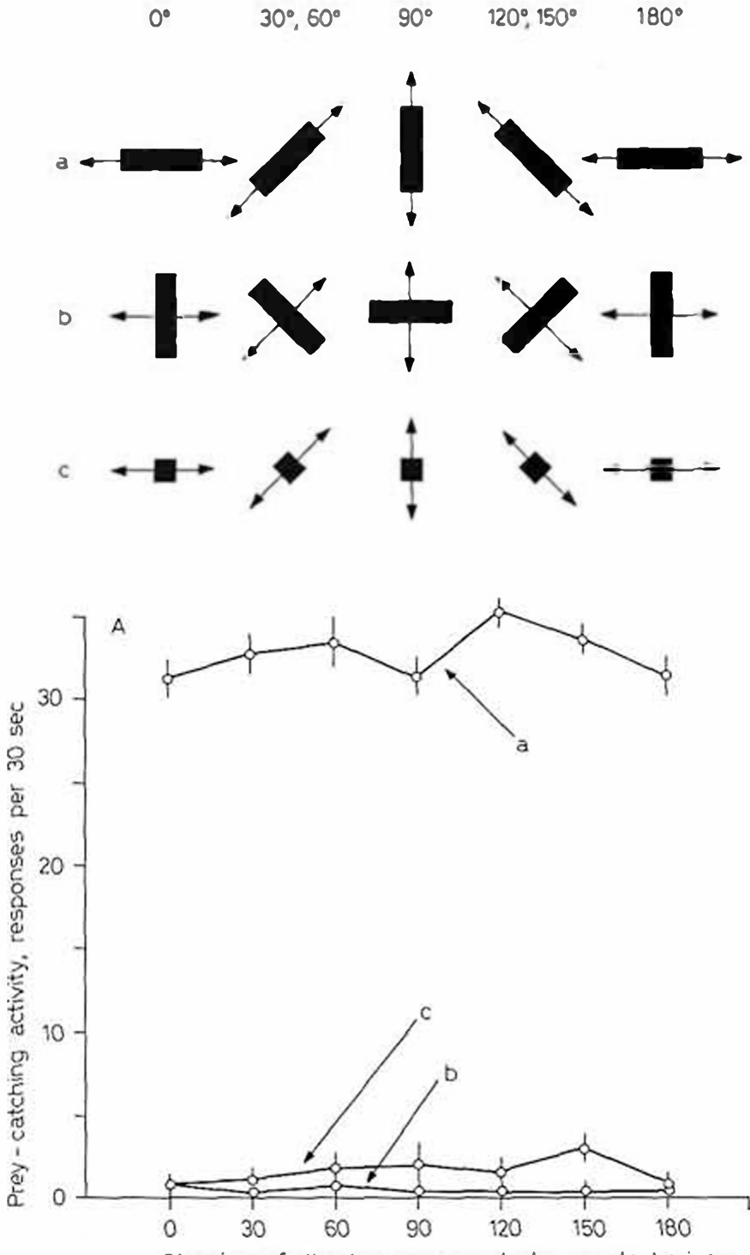
Prey selection is invariant to movement direction
Ewert et al. then moved the stimuli horizontally, diagonally at 30°, 60°, 120° and 150°, and vertically, always at 20°/s. A 2.5 × 30 mm stripe oriented along its direction of motion (a) was compared with the same stripe oriented across it (b) and with a small 2.5 × 2.5 mm square (c).
At every direction the worm released about 30 turns per 30 s, while the antiworm and the small square released almost none. The toad made essentially no errors in classifying worm against antiworm at any angle.
An invariant is a property of recognition that does not change when other stimulus parameters change. The worm–antiworm discrimination is invariant to the direction of movement in the visual field, to contrast direction and, within limits, to velocity and distance.
Ewert et al. (1979), Fig. 3A. Turning to a worm stripe (a), antiworm stripe (b) and small square (c) moved at different angles to the horizon.
Ewert et al. (1979)
06
Notes:
• Here the stimuli moved in many directions: sideways, diagonally and up and down.
– The worm, the antiworm and a small square were each tested at every angle.
• At every angle the worm drew about 30 turns in 30 seconds, while the antiworm and the small square drew almost none.
– The toad essentially never mistook one for the other.
• An invariant is a feature of recognition that stays the same when other things about the stimulus change. For the toad, the worm–antiworm decision is invariant to movement direction, contrast direction and, within limits, speed and distance.
References:
Ewert JP, Arend B, Becker V, Borchers HW (1979). Invariants in configurational prey selection by Bufo bufo (L.). Brain, Behavior and Evolution 16: 38–51. https://doi.org/10.1159/000121822
Figure: Ewert et al. (1979), Fig. 3A. Turning to a worm stripe (a), antiworm stripe (b) and small square (c) moved at different angles to the horizon.
Figure source: https://doi.org/10.1159/000121822

Slide 8
Motion turns stripe orientation into time and space
On a retinotopic map, motion decides how a stripe's two edge lengths reach the brain. A worm slides along its own axis, so one point of the visual field stays covered for a time that grows with its length. An antiworm covers a wide band of neighboring points at once, each only briefly.
A stationary stripe gives a round receptive field no such difference: rotated about the field's center, it covers the same area. Movement converts extension along the path into duration at each location and extension across it into breadth of simultaneous activity.
Such a comparison would explain why one rule holds at every angle tested. Both measures are taken relative to the stripe's own path, so circular fields, like those of frog T5(2) cells at about 18°, could classify worms moving in any direction.
Ewert et al. (1979), Fig. 3A. Turning to a worm stripe (a), antiworm stripe (b) and small square (c) moved at different angles to the horizon.
Ewert et al. (1979); Schürg-Pfeiffer & Ewert (1981)
06a
Notes:
• The worm and antiworm rule is defined relative to the direction of motion, and the geometry of a moving stripe on a retinotopic map gives a concrete way to see why that matters.
• Two edges, two kinds of signal.
– When a 2.5 by 30 millimeter stripe moves lengthwise, any given spot in the visual field sees black for a long stretch of time, but only a narrow column of spots is covered at any one instant.
– Turn the same stripe crosswise and the pattern inverts: many neighboring spots are covered together, and each is uncovered again almost immediately.
• Why motion is required.
– Slide 13 introduces the retinotopic maps of tectum and pretectum, where neighboring places in the visual field are handled by neighboring neurons.
– Without motion, a round receptive field receives the same amount of black whichever way the stripe is turned, so orientation alone gives such a cell nothing to work with.
• Invariance follows.
– Slide 6 reports the same discrimination for horizontal, diagonal and vertical paths.
– If the brain compares time at a location with breadth across locations, that comparison is tied to the path of the stimulus and therefore works at any angle.
– The roughly 18 degree circular fields on slide 15 fit this kind of computation, although Ewert's papers present the comparison as a proposal about how inputs combine.
References:
Ewert JP, Arend B, Becker V, Borchers HW (1979). Invariants in configurational prey selection by Bufo bufo (L.). Brain, Behavior and Evolution 16: 38–51. https://doi.org/10.1159/000121822
Schürg-Pfeiffer E, Ewert JP (1981). Investigation of neurons involved in the analysis of gestalt prey features in the frog Rana temporaria. Journal of Comparative Physiology 141: 139–152. https://doi.org/10.1007/BF01342660

Slide 9
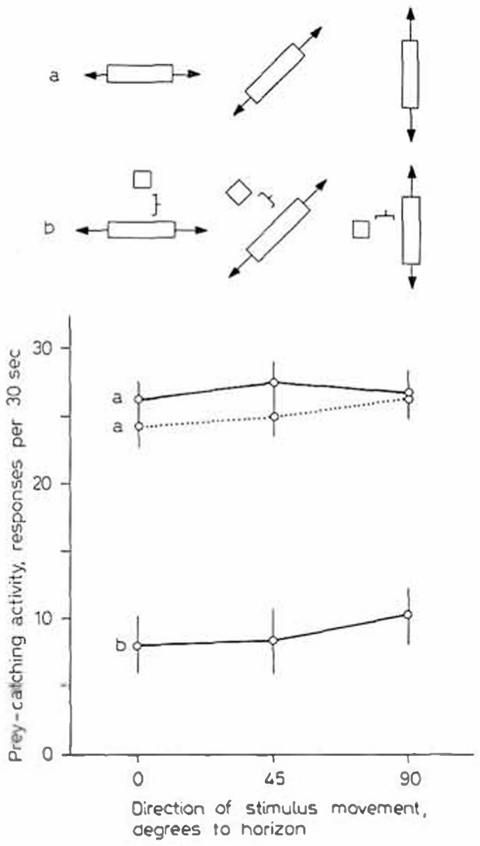
A nearby square reduces the prey value of a worm
Ewert et al. tested how a second element changes recognition. A 2.5 × 30 mm worm stripe was moved alone (a) or together with a 2.5 × 2.5 mm square placed 10 mm from it (b).
Adding the square reduced prey-catching from about 26 turns per 30 s to about 8–10 turns, at horizontal, diagonal and vertical directions alike. When the stripe was tested alone again (a'), responses returned to their original level.
The square adds extension across the direction of movement of the whole configuration, which the toad treats as an antiworm feature. The inhibitory effect therefore follows the same configurational rule, and it too is independent of movement direction.
Ewert et al. (1979), Fig. 4. Turning to a worm stripe alone (a, a') and to the stripe with a small square 10 mm away (b), at 0°, 45° and 90°.
Ewert et al. (1979)
07
Notes:
• This experiment added a small square next to a worm stripe.
– The square sat 10 millimeters from the stripe and moved with it.
• The square sharply reduced turning, from about 26 to about 8 to 10 turns per 30 seconds, whatever the direction of movement.
– When the stripe was shown alone again, the toad responded normally.
• The square adds extent across the direction of motion, an antiworm feature, so the combined object looks less like prey.
References:
Ewert JP, Arend B, Becker V, Borchers HW (1979). Invariants in configurational prey selection by Bufo bufo (L.). Brain, Behavior and Evolution 16: 38–51. https://doi.org/10.1159/000121822
Figure: Ewert et al. (1979), Fig. 4. Turning to a worm stripe alone (a, a') and to the stripe with a small square 10 mm away (b), at 0°, 45° and 90°.
Figure source: https://doi.org/10.1159/000121822

Slide 10
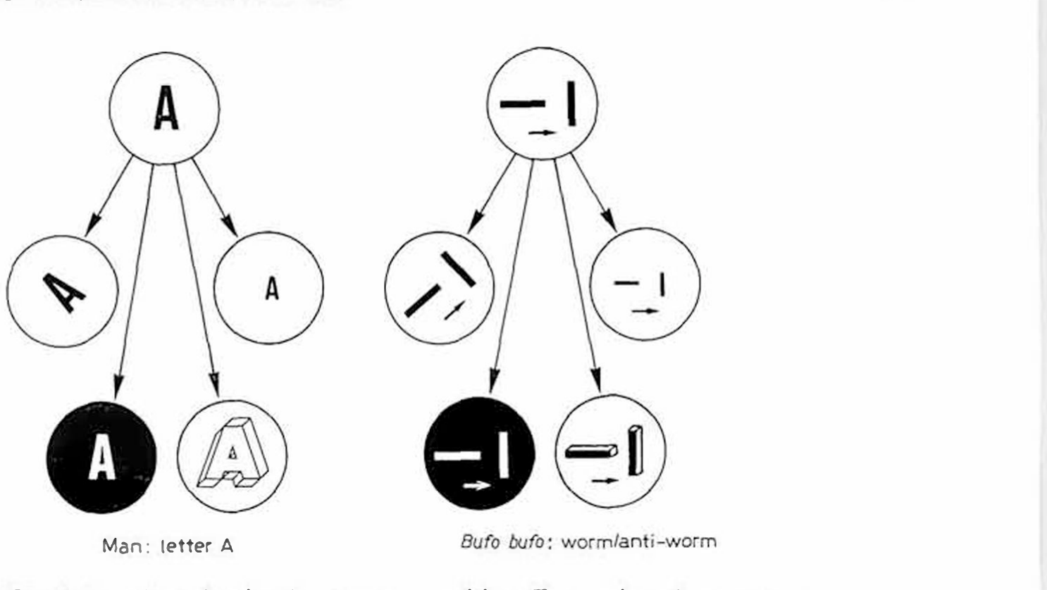
Recognition invariants resemble human object recognition
Ewert et al. compared the toad's prey recognition with how humans recognize a symbol. A person identifies the letter A whether it is tilted, small or large, or drawn in white on black. In the same way, a toad identifies a worm whether it moves horizontally or vertically, and whether it is black on white or white on black.
Ewert proposed that such invariants make the toad a useful model for the mechanism of object recognition. Neurons in the optic tectum and the thalamic–pretectal region respond to configurational features of moving stimuli, and their receptive fields are approximately radially symmetrical, so their selectivity must come from the way information about extension along and across the direction of movement is combined.
Ewert et al. (1979), Fig. 6. Invariants in pattern recognition: the letter A for a human and worm versus antiworm for Bufo bufo.
Ewert et al. (1979)
08
Notes:
• Ewert compared the toad's worm recognition with how we recognize the letter A.
– We recognize the A when it is tilted, smaller or larger, or white on black.
• The toad recognizes a worm when it moves in any direction and in either contrast, so its recognition also has invariants.
• That makes the toad a model for how a brain recognizes objects.
– The relevant neurons in the tectum and pretectum have roughly circular receptive fields, so their preference for worms has to come from how the brain combines information about length along and across the movement direction.
References:
Ewert JP, Arend B, Becker V, Borchers HW (1979). Invariants in configurational prey selection by Bufo bufo (L.). Brain, Behavior and Evolution 16: 38–51. https://doi.org/10.1159/000121822
Figure: Ewert et al. (1979), Fig. 6. Invariants in pattern recognition: the letter A for a human and worm versus antiworm for Bufo bufo.
Figure source: https://doi.org/10.1159/000121822

Slide 11
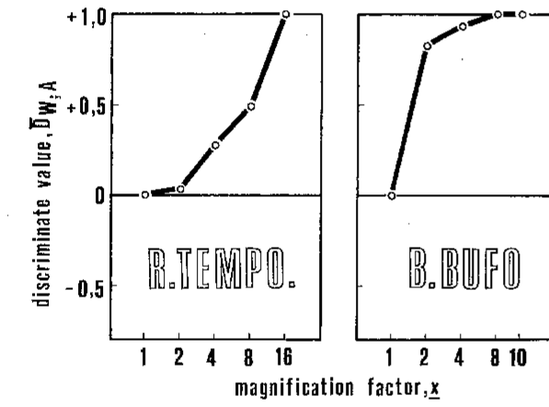
Frogs and toads differ in how sharply they reject antiworms
Schürg-Pfeiffer and Ewert compared configurational selectivity in the frog Rana temporaria and the toad Bufo bufo. They used a discriminant value, D(W,A), which equals +1 when only the worm releases a response, −1 when only the antiworm does and 0 when both are equally effective.
In both species D(W,A) rose with stripe length, so both prefer worms. The toad's curve rose steeply and reached +1 at short lengths, whereas the frog's rose gradually and reached +1 only for long stripes.
This difference fits the species' hunting strategies. The actively hunting toad is relatively selective, whereas the sit-and-wait frog, which depends on a low snapping threshold, also catches non-prey items occasionally.
Schürg-Pfeiffer & Ewert (1981), Fig. 12. Discriminant value for worm versus antiworm during prey-catching in R. temporaria and B. bufo as stripe length increases.
Schürg-Pfeiffer & Ewert (1981); Ewert et al. (2001)
09
Notes:
• Schürg-Pfeiffer and Ewert compared the common frog and the common toad with one number, the discriminant value.
– It is plus one if only the worm gets a response, minus one if only the antiworm does, and zero if they are equal.
• Both species prefer worms, but the toad is much sharper.
– The toad's value reaches plus one with short stripes, while the frog needs long stripes to discriminate completely.
• That matches how they hunt. The toad searches actively and is selective; the frog waits and snaps at more things, including non-prey.
References:
Schürg-Pfeiffer E, Ewert JP (1981). Investigation of neurons involved in the analysis of gestalt prey features in the frog Rana temporaria. Journal of Comparative Physiology 141: 139–152. https://doi.org/10.1007/BF01342660
Ewert JP, Buxbaum-Conradi H, Dreisvogt F, Glagow M, Merkel-Harff C, Röttgen A, Schürg-Pfeiffer E, Schwippert WW (2001). Neural modulation of visuomotor functions underlying prey-catching behaviour in anurans: perception, attention, motor performance, learning. Comparative Biochemistry and Physiology A 128: 417–461. https://doi.org/10.1016/S1095-6433(00)00333-0
Figure: Schürg-Pfeiffer & Ewert (1981), Fig. 12. Discriminant value for worm versus antiworm during prey-catching in R. temporaria and B. bufo as stripe length increases.
Figure source: https://doi.org/10.1007/BF01342660

Slide 12
Discriminant values separate preference from vigor
Raw turning counts mix two properties: how readily an animal responds at all, and how strongly it prefers one configuration. A frog with a low snapping threshold could respond more often than a toad to both stripes and still discriminate worse. D(W,A) depends only on the balance between worm and antiworm responses.
White stripes on black lowered turning overall yet left the worm preference intact, a change in level without a change in selectivity. Under apomorphine, snapping rose while discrimination became less sharp.
A bounded scale also makes behavior and neurons comparable. A retinal cell and a toad produce very different numbers of spikes or turns, yet each yields a D(W,A) curve against stripe length, and matching curves mark neurons whose preference tracks the animal's.
Schürg-Pfeiffer & Ewert (1981), Fig. 12. Discriminant value for worm versus antiworm during prey-catching in R. temporaria and B. bufo as stripe length increases.
Schürg-Pfeiffer & Ewert (1981); Ewert et al. (1978)
09a
Notes:
• The discriminant value looks like a bookkeeping device, but it solves a real problem: separating how much an animal responds from what it prefers.
• Two properties hidden in one count.
– An animal that turns often to everything and an animal that turns rarely can still favor the worm by the same proportion.
– Their raw counts differ, yet the discriminant value treats them alike, since it registers only the balance between the two stripes.
– That matters for the frog and toad comparison on slide 9, since the sit-and-wait frog responds readily to many objects.
• Level and selectivity move independently.
– On slide 5, contrast direction changes response level while the configurational preference stays put.
– Under apomorphine on slide 27, snapping rises while discrimination becomes less acute, a case where the two properties move apart in the other direction.
• Putting neurons and behavior on one scale.
– Slides 11 and 12 rely on this normalization, because a neuron's spike count and a toad's turning count have no common units.
– Once both are expressed as discriminant values, the shape of the curve against stripe length can be compared directly, which is how T5(2) neurons were singled out.
References:
Schürg-Pfeiffer E, Ewert JP (1981). Investigation of neurons involved in the analysis of gestalt prey features in the frog Rana temporaria. Journal of Comparative Physiology 141: 139–152. https://doi.org/10.1007/BF01342660
Ewert JP, Borchers HW, von Wietersheim A (1978). Question of prey feature detectors in the toad's Bufo bufo (L.) visual system: a correlation analysis. Journal of Comparative Physiology 126: 43–47. https://doi.org/10.1007/BF01342649

Slide 13
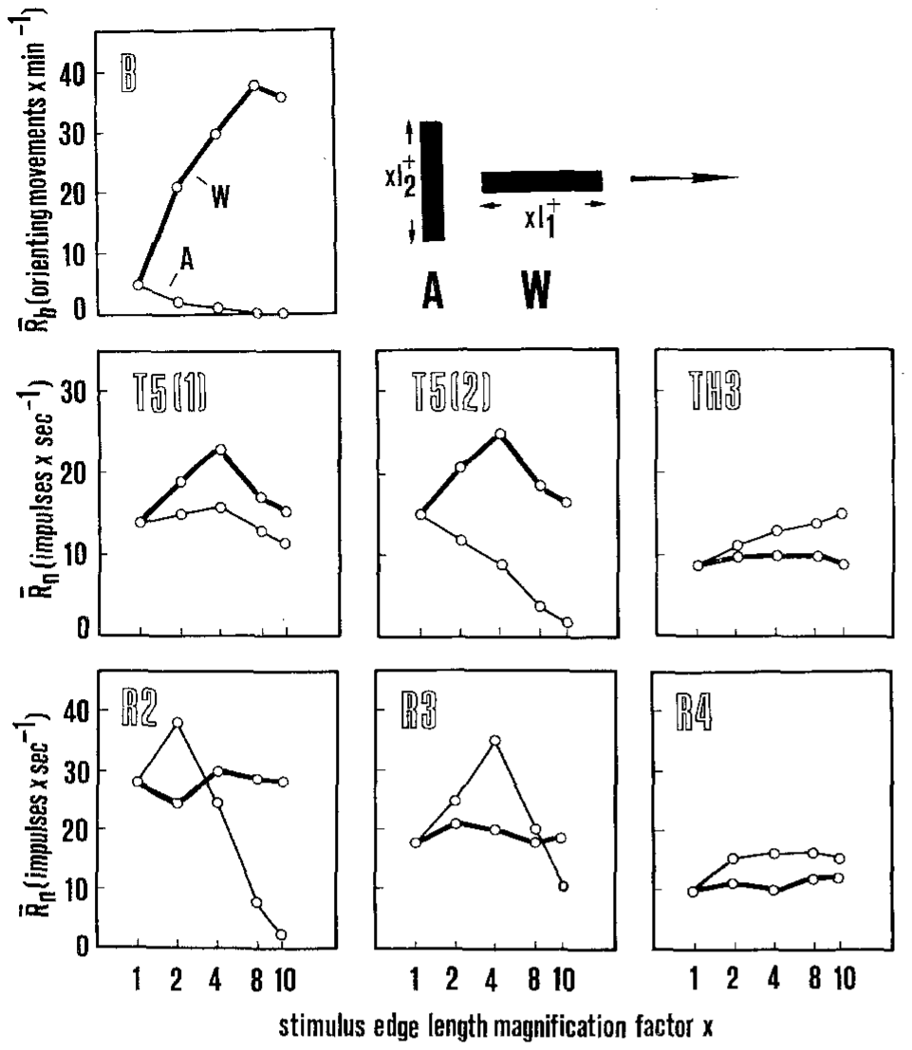
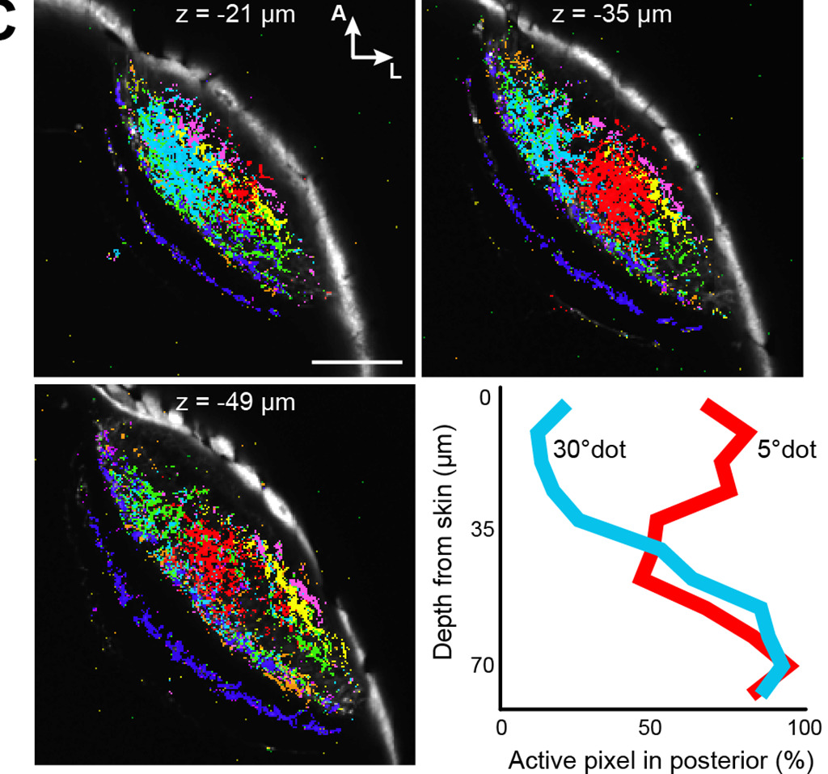
Retinal ganglion cells encode size, not configuration
In the 1950s Barlow and Lettvin proposed that a class of frog retinal ganglion cell acts as a "bug detector". Retinal ganglion cells are the output neurons of the retina. Toad ganglion cells fall into classes R1–R4, with excitatory receptive fields of about 2–3°, 4–6°, 8–10° and 12–16° respectively, each surrounded by an inhibitory zone.
Ewert, Borchers and von Wietersheim recorded R2, R3 and R4 cells while worm-like (W) and antiworm-like (A) stripes crossed their receptive fields. R2 cells responded best to small stimuli of either configuration and declined as stripes lengthened in both orientations.
No retinal class reproduced the toad's behavior, which rose for worms and fell for antiworms. Grüsser concluded from such data that no ganglion cell type is specific to prey; the retina parcels the image by size, contrast and movement.
Ewert et al. (1978), Fig. 1. Turning (B) and firing of tectal T5(1), T5(2), pretectal TH3 and retinal R2–R4 neurons to worm (W) and antiworm (A) stripes.
Förster et al. (2020), Fig. 3C. Zebrafish retinal axon terminals in the tectum colored by functional class; 5°-dot and 30°-dot inputs by depth.
Ewert et al. (1978); Ewert (1997); Förster et al. (2020)
10
Notes:
• Barlow and Lettvin in the 1950s suggested that a type of frog retinal ganglion cell was a bug detector.
– Ganglion cells are the output neurons of the retina, and in the toad they come in four classes, R1 to R4, with progressively larger receptive fields.
• Ewert's group tested R2, R3 and R4 cells with worm and antiworm stripes.
– R2 cells fired best to small objects of either kind and fired less as stripes got longer in either orientation.
• No retinal class matched the toad's behavior, which goes up for worms and down for antiworms. The retina reports size, contrast and movement, but it does not identify prey.
References:
Ewert JP, Borchers HW, von Wietersheim A (1978). Question of prey feature detectors in the toad's Bufo bufo (L.) visual system: a correlation analysis. Journal of Comparative Physiology 126: 43–47. https://doi.org/10.1007/BF01342649
Ewert JP (1997). Neural correlates of key stimulus and releasing mechanism: a case study and two concepts. Trends in Neurosciences 20(8): 332–339. https://doi.org/10.1016/S0166-2236(96)01042-9
Förster D, Helmbrecht TO, Mearns DS, Jordan L, Mokayes N, Baier H (2020). Retinotectal circuitry of larval zebrafish is adapted to detection and pursuit of prey. eLife 9: e58596. https://doi.org/10.7554/eLife.58596
Figure: Ewert et al. (1978), Fig. 1. Turning (B) and firing of tectal T5(1), T5(2), pretectal TH3 and retinal R2–R4 neurons to worm (W) and antiworm (A) stripes.
Figure source: https://doi.org/10.1007/BF01342649
Figure: Förster et al. (2020), Fig. 3C. Zebrafish retinal axon terminals in the tectum colored by functional class; 5°-dot and 30°-dot inputs by depth.
Figure source: https://doi.org/10.7554/eLife.58596

Slide 14
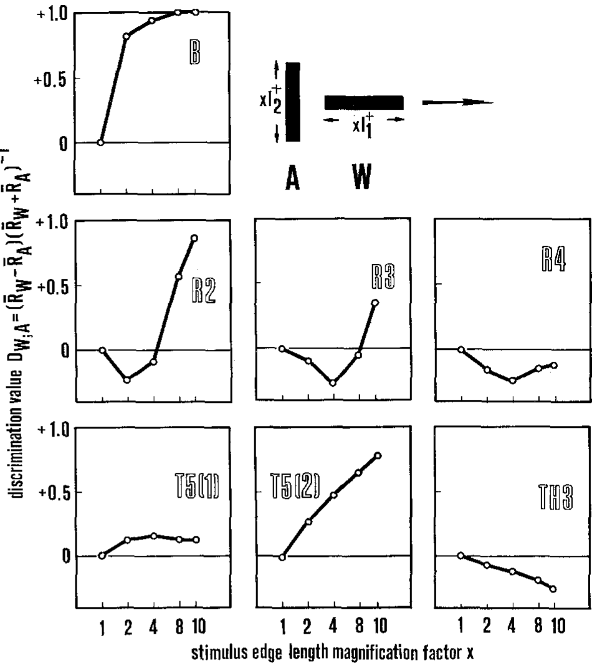
Only tectal T5(2) neurons match the toad's discrimination
Ewert et al. computed the discriminant value D(W,A) for behavior and for each neuron class, and correlated the stimulus–response curves.
The behavioral curve rose to +1. Retinal R2 and R3 values were negative for short stripes and rose only at long lengths; R4 stayed near zero. Tectal T5(1) neurons were sensitive to configuration but hardly discriminated, and pretectal TH3 neurons had negative values, preferring antiworms.
Only tectal T5(2) neurons had a curve resembling the behavior. Ewert classed neurons as sensitive (responding to configurational stimuli), selective (responding differentially in the same way as behavior) or specific (responding to one configuration only). T5(2) neurons were selective, but no neuron was specific: no single "worm detector" cell was found.
Ewert et al. (1978), Fig. 2. Discriminant value D(W,A) for behavior (B) and for retinal (R2–R4), tectal (T5(1), T5(2)) and pretectal (TH3) neurons.
Ewert et al. (1978)
11
Notes:
• Ewert's group then compared every neuron class with behavior using the discriminant value.
– Behavior went to plus one; the retinal classes were negative or near zero for most stripe lengths.
• In the tectum, T5(1) neurons responded to the stimuli but barely told worm from antiworm.
– Pretectal TH3 neurons had negative values, meaning they preferred antiworms.
• Only tectal T5(2) neurons followed the behavior.
– Ewert called them selective, because they discriminate the way the toad does.
– But none were specific, responding only to worms, so there is no single worm-detector neuron.
References:
Ewert JP, Borchers HW, von Wietersheim A (1978). Question of prey feature detectors in the toad's Bufo bufo (L.) visual system: a correlation analysis. Journal of Comparative Physiology 126: 43–47. https://doi.org/10.1007/BF01342649
Figure: Ewert et al. (1978), Fig. 2. Discriminant value D(W,A) for behavior (B) and for retinal (R2–R4), tectal (T5(1), T5(2)) and pretectal (TH3) neurons.
Figure source: https://doi.org/10.1007/BF01342649

Slide 15
Selective cells need partners to identify prey
A selective neuron's firing rate alone is ambiguous. The frog T5(2) cell fired strongly to long worms but also to squares near 8°, so a moderate burst could come from a short worm, a medium square or an object at the edge of the field.
The ambiguity shrinks when classes are read together. A worm drives T5(2) while leaving pretectal TH3, which favors extension across the path, nearly silent; a large square drives TH3 and the avoidance-like T5.4 class. The prey label lies in the pattern across classes.
Selectivity without specificity fits this arrangement: a few broadly tuned classes mark prey and predator through their combinations. Pretectal neurons also project to the tectum and inhibit it, so the circuit itself performs the comparison.
Ewert et al. (1978), Fig. 2. Discriminant value D(W,A) for behavior (B) and for retinal (R2–R4), tectal (T5(1), T5(2)) and pretectal (TH3) neurons.
Ewert et al. (1978); Schürg-Pfeiffer & Ewert (1981); Ewert (1997)
11a
Notes:
• The absence of a specific worm detector is a statement about how information is distributed, and it explains why the deck moves from single cells to combinations of cell classes.
• One cell, many possible causes.
– The spike trains on slide 15 show the same T5(2) neuron responding well to an 8 degree square and to lengthening worms.
– Any given firing rate is therefore compatible with more than one object, and stimulus size, position in the field and configuration all trade off against each other.
• Reading several classes at once.
– Slide 16 lays out the classes side by side: T5.2 follows prey-catching, TH3 and T5.3 favor large extension across the path, and T5.4 follows avoidance.
– A worm and a large square differ sharply in the joint pattern across these classes even when one class alone might give similar rates.
– Ewert's sensorimotor codes on slide 20 are built on exactly this joint pattern.
• The circuit performs the comparison.
– The pretectum is not merely another class an experimenter can record; according to slide 18 it inhibits tectal neurons.
– So the brain does not need a separate decoder to compare T5(2) with TH3, since TH3 activity directly reduces tectal output when the stimulus is not prey-like.
References:
Ewert JP, Borchers HW, von Wietersheim A (1978). Question of prey feature detectors in the toad's Bufo bufo (L.) visual system: a correlation analysis. Journal of Comparative Physiology 126: 43–47. https://doi.org/10.1007/BF01342649
Schürg-Pfeiffer E, Ewert JP (1981). Investigation of neurons involved in the analysis of gestalt prey features in the frog Rana temporaria. Journal of Comparative Physiology 141: 139–152. https://doi.org/10.1007/BF01342660
Ewert JP (1997). Neural correlates of key stimulus and releasing mechanism: a case study and two concepts. Trends in Neurosciences 20(8): 332–339. https://doi.org/10.1016/S0166-2236(96)01042-9

Slide 16
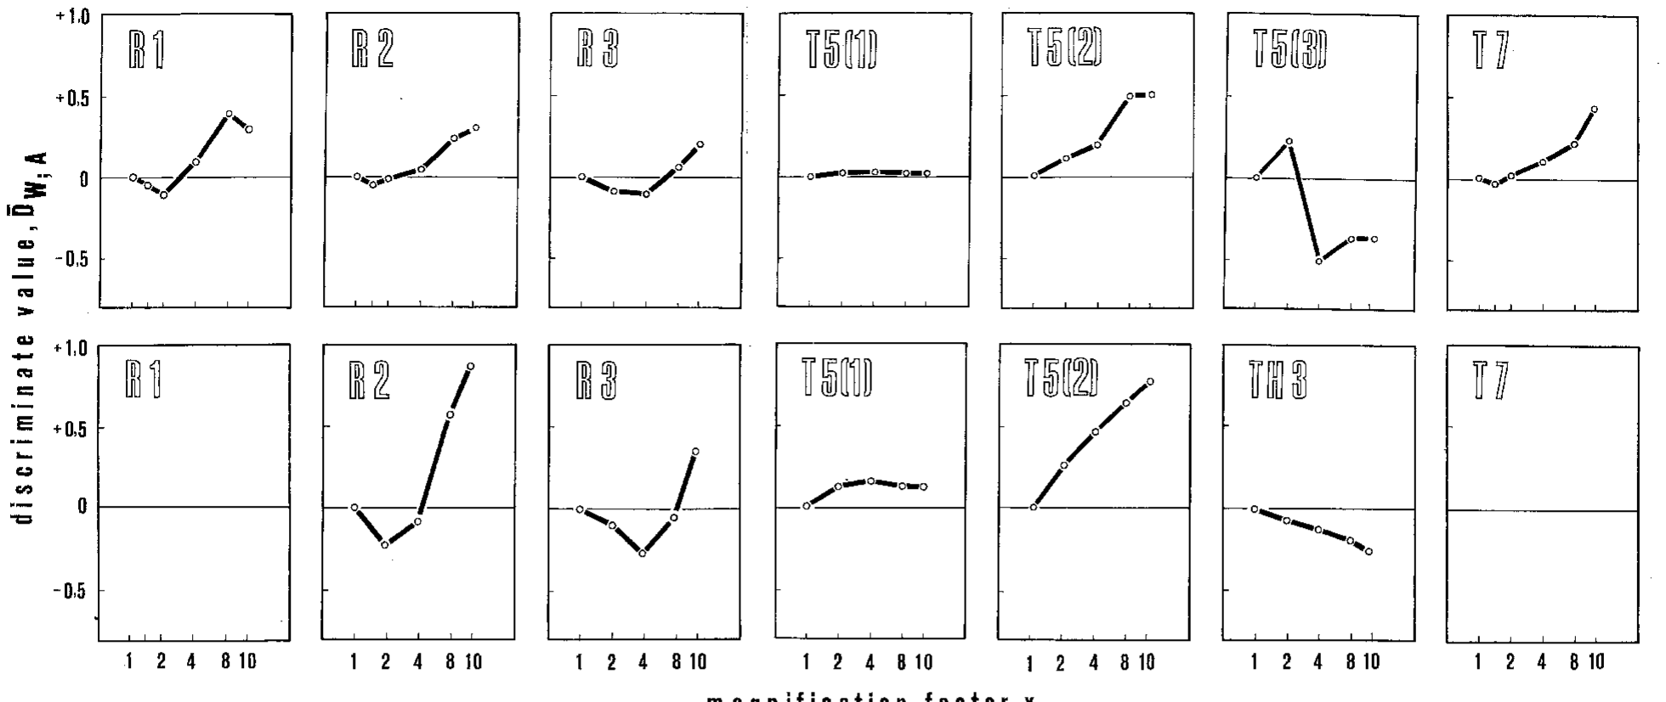
Frog tectal neurons show the same division of labor
Schürg-Pfeiffer and Ewert recorded 63 single neurons in the frog Rana temporaria: retinal classes R1–R3 and tectal classes T5(1), T5(2), T5(3) and T7.
Retinal cells preferred antiworms when stripes were shorter than their excitatory receptive field and worms only when stripes were longer, as expected from a centre–surround organization. Tectal T5(1) neurons showed almost no configurational preference, T5(2) neurons preferred worms, and T5(3) neurons preferred antiworms, resembling pretectal TH3 cells.
Plotted side by side, frog and toad neuron classes have similar shapes, but the toad's retinal (R2, R3) and tectal (T5(1), T5(2)) selectivities are sharper. This parallels the sharper discrimination of the toad's behavior.
Schürg-Pfeiffer & Ewert (1981), Fig. 11. Discriminant values of retinal and tectal neuron classes in R. temporaria (above) and B. bufo (below) versus stripe length.
Schürg-Pfeiffer & Ewert (1981)
12
Notes:
• The same analysis was done in the frog with 63 neurons from the retina and tectum.
– Retinal cells preferred antiworms for short stripes and worms for long stripes, which follows from their centre–surround receptive fields.
• In the tectum, three classes had three different preferences.
– T5(1) cells barely cared about configuration, T5(2) cells preferred worms, and T5(3) cells preferred antiworms, much like pretectal TH3 cells in the toad.
• Frog and toad have the same neuron classes, but the toad's are more selective, which matches its more selective behavior.
References:
Schürg-Pfeiffer E, Ewert JP (1981). Investigation of neurons involved in the analysis of gestalt prey features in the frog Rana temporaria. Journal of Comparative Physiology 141: 139–152. https://doi.org/10.1007/BF01342660
Figure: Schürg-Pfeiffer & Ewert (1981), Fig. 11. Discriminant values of retinal and tectal neuron classes in R. temporaria (above) and B. bufo (below) versus stripe length.
Figure source: https://doi.org/10.1007/BF01342660

Slide 17
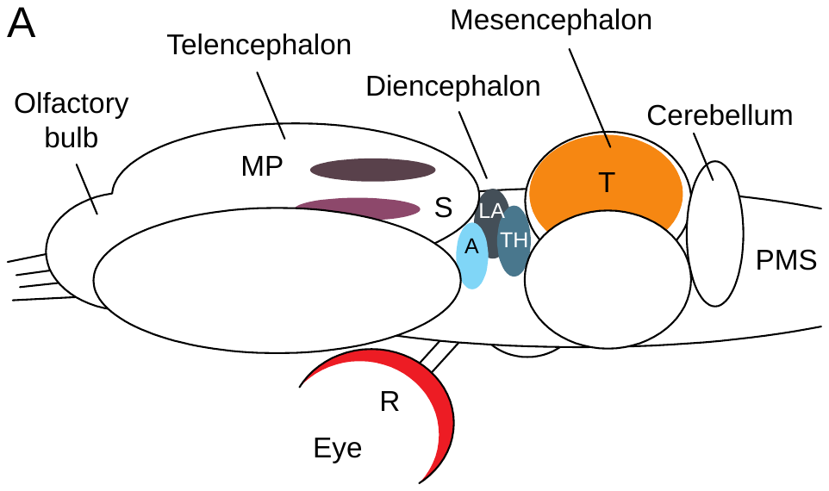
Retina, tectum and pretectum feed visual prey-catching
The optic tectum (T), in the roof of the midbrain, is the main target of the retina (R). It is homologous to the mammalian superior colliculus. The pretectal thalamic region (TH), at the boundary of diencephalon and midbrain, also receives retinal input. Both contain retinotopic maps, in which neighboring points in the visual field are represented by neighboring neurons.
Outputs from tectum and pretectum descend to premotor and motor structures (PMS) in the medulla oblongata and spinal cord that generate orienting and snapping.
Forebrain structures modulate this pathway: the striatum (S) and the lateral anterior thalamic nucleus (LA) take part in response gating, and the medial pallium (MP), the amphibian homolog of the hippocampus, takes part in learning.
Ewert (1997), Fig. 1A. Anuran brain: retina (R), optic tectum (T), pretectal thalamus (TH), striatum (S), medial pallium (MP) and premotor–motor structures (PMS).
Ewert (1997); Ewert et al. (2001)
13
Notes:
• The main structures are the retina, the optic tectum and the pretectal thalamus.
– The tectum is in the roof of the midbrain and corresponds to the mammalian superior colliculus; the pretectum lies just in front of it.
– Both have retinotopic maps, where neighboring points in space map onto neighboring neurons.
• Their output goes down to premotor and motor structures in the medulla and spinal cord that produce turning and snapping.
• Forebrain areas modulate this pathway: the striatum and lateral anterior thalamus help gate responses, and the medial pallium, the amphibian hippocampus, is involved in learning.
References:
Ewert JP (1997). Neural correlates of key stimulus and releasing mechanism: a case study and two concepts. Trends in Neurosciences 20(8): 332–339. https://doi.org/10.1016/S0166-2236(96)01042-9
Ewert JP, Buxbaum-Conradi H, Dreisvogt F, Glagow M, Merkel-Harff C, Röttgen A, Schürg-Pfeiffer E, Schwippert WW (2001). Neural modulation of visuomotor functions underlying prey-catching behaviour in anurans: perception, attention, motor performance, learning. Comparative Biochemistry and Physiology A 128: 417–461. https://doi.org/10.1016/S1095-6433(00)00333-0
Figure: Ewert (1997), Fig. 1A. Anuran brain: retina (R), optic tectum (T), pretectal thalamus (TH), striatum (S), medial pallium (MP) and premotor–motor structures (PMS).
Figure source: https://doi.org/10.1016/S0166-2236(96)01042-9

Slide 18
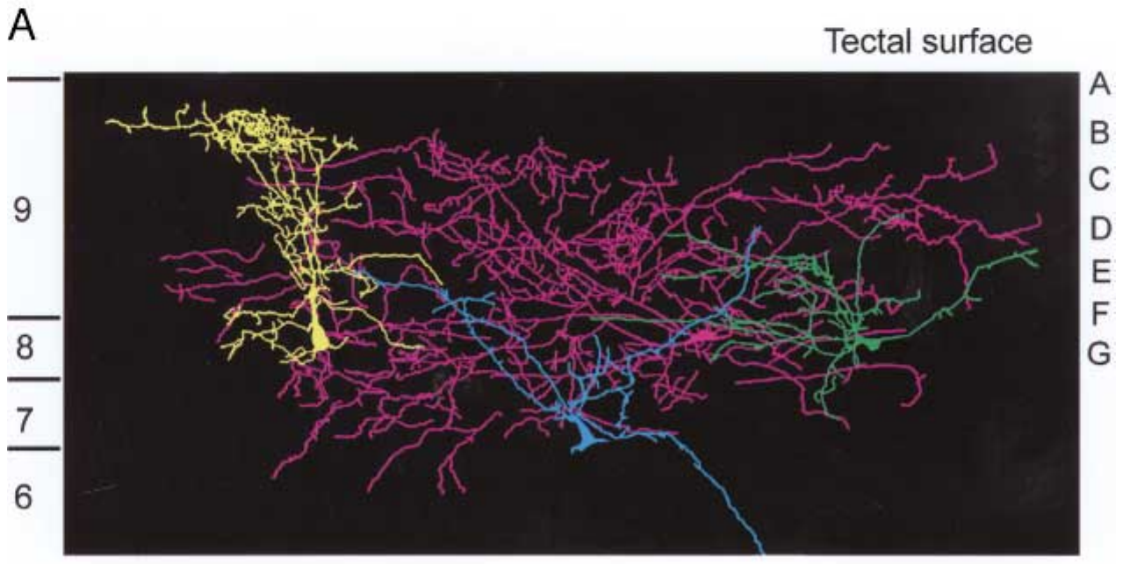
Tectal neurons collect input across retinal layers
Retinal ganglion cell axons end in different layers of the superficial tectum: R2 in laminae B–C, R3 in C–F and R4 in F–G. Neuropeptide-Y fibers from the pretectum end mainly in laminae B and C.
Intracellular recordings followed by cobalt-lysine filling revealed tectal neurons whose dendrites span several of these laminae. A pear-shaped T5.1 cell (yellow) arborizes from lamina B through G and can integrate inputs from several retinal classes. Another T5.1 subtype (green) spreads laterally, suited to interactions across the tectal map. A large neuron (violet) responds to any moving stimulus. The T5.2 pyramidal cell (blue) integrates inputs from layers 8 and 9 and sends its axon toward the medulla oblongata.
This anatomy allows each tectal output neuron to combine several retinal channels with pretectal input.
Ewert (1997), Fig. 2A. Cobalt-filled tectal neurons (T5.1 yellow and green, large neuron violet, T5.2 blue) spanning tectal laminae A–G.
Ewert (1997)
14
Notes:
• Each retinal class ends in its own layers of the tectum.
– R2 axons end in laminae B and C, R3 in C to F, and R4 in F and G, and inhibitory fibers from the pretectum end mainly in B and C.
• Tectal neurons reach across these layers.
– The yellow T5.1 cell has dendrites from lamina B to G, so it can combine several retinal classes.
– The blue T5.2 cell collects input from layers 8 and 9 and sends its axon down to the medulla.
• Because the dendrites cross layers, each tectal output neuron can mix several retinal channels and pretectal input.
References:
Ewert JP (1997). Neural correlates of key stimulus and releasing mechanism: a case study and two concepts. Trends in Neurosciences 20(8): 332–339. https://doi.org/10.1016/S0166-2236(96)01042-9
Figure: Ewert (1997), Fig. 2A. Cobalt-filled tectal neurons (T5.1 yellow and green, large neuron violet, T5.2 blue) spanning tectal laminae A–G.
Figure source: https://doi.org/10.1016/S0166-2236(96)01042-9

Slide 19
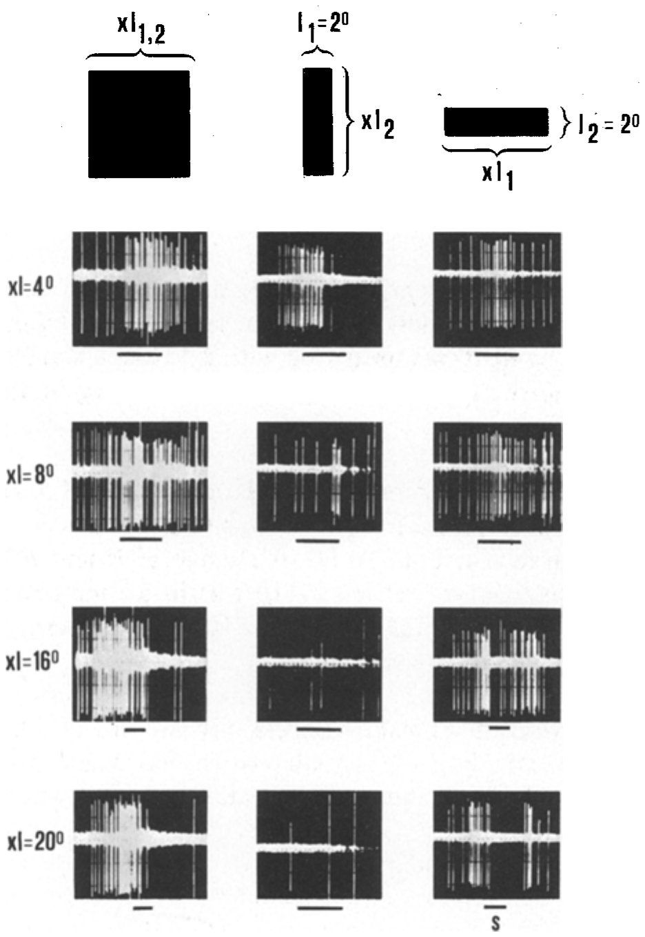
T5(2) neurons fire to worms but weakly to antiworms
Schürg-Pfeiffer and Ewert showed the spike trains of a frog T5(2) neuron to squares, worm-like stripes and antiworm-like stripes of increasing length.
For squares (left column), firing increased up to 8° and then fell. For stripes extended along the direction of movement (right column), firing remained strong as the stripe lengthened. For stripes extended across the direction of movement (middle column), firing weakened progressively as the stripe became longer.
The excitatory receptive field of these cells averaged about 18° in diameter and is roughly circular, so the worm preference is not simply a matter of receptive-field shape. It depends on interactions between the stimulus's extension along and across its path, the same relation the toad's behavior expresses.
Schürg-Pfeiffer & Ewert (1981), Fig. 8. Spike trains of a T5(2) neuron to squares, antiworm (middle) and worm (right) stripes of 4–20° length; time scale 1 s.
Schürg-Pfeiffer & Ewert (1981)
15
Notes:
• These are spike trains from one frog T5(2) neuron.
– Squares drove it best at about 8 degrees, and larger squares drove it less.
• Worm-like stripes kept driving it strongly as they got longer, but antiworm stripes drove it less and less.
– That is the same preference the animal shows in behavior.
• Its receptive field is round, about 18 degrees across, so the preference cannot come from the shape of the field; it comes from how the cell's inputs combine length along and across the motion.
References:
Schürg-Pfeiffer E, Ewert JP (1981). Investigation of neurons involved in the analysis of gestalt prey features in the frog Rana temporaria. Journal of Comparative Physiology 141: 139–152. https://doi.org/10.1007/BF01342660
Figure: Schürg-Pfeiffer & Ewert (1981), Fig. 8. Spike trains of a T5(2) neuron to squares, antiworm (middle) and worm (right) stripes of 4–20° length; time scale 1 s.
Figure source: https://doi.org/10.1007/BF01342660

Slide 20
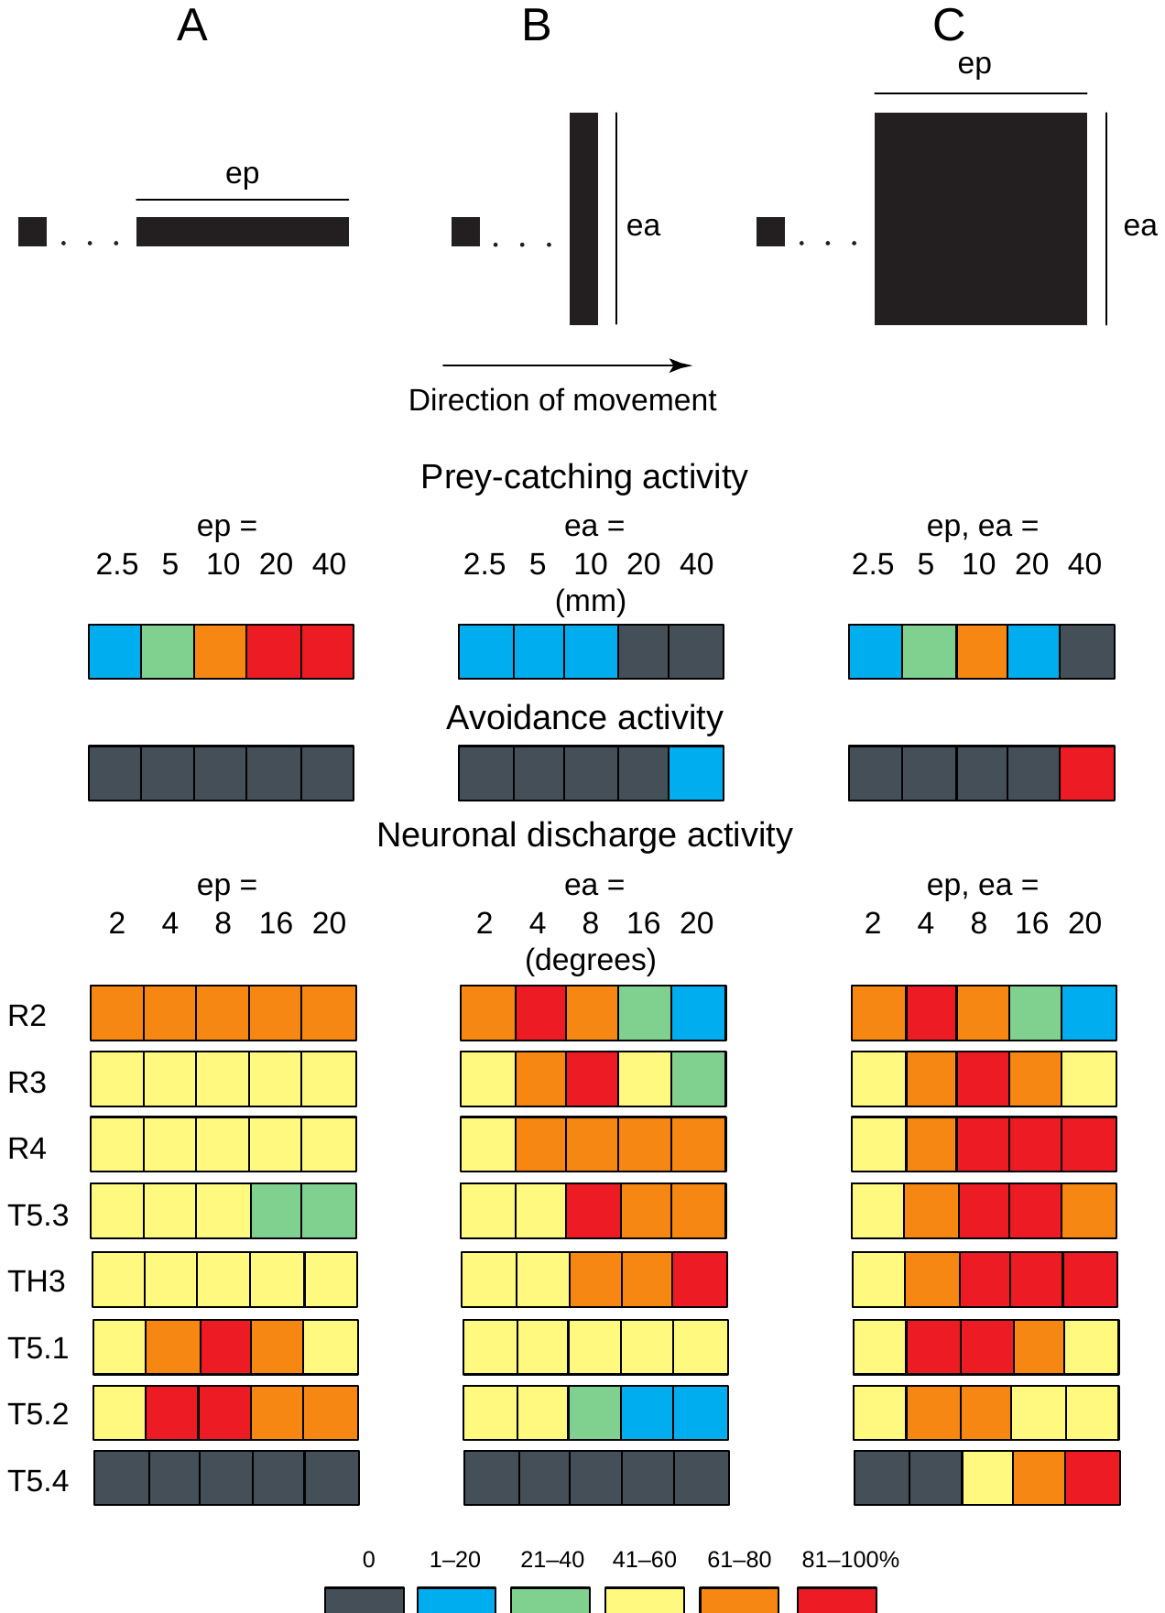
Retina, tectum and pretectum code ep and ea differently
Ewert summarized responses to ep, ea and square size in a color-coded table, with each response scaled to the optimal stimulus.
Prey-catching rose with ep, fell with ea and peaked for intermediate squares. Avoidance behavior showed the reverse, rising for large squares. Retinal R2, R3 and R4 cells responded to ea and to square area according to their receptive-field size. Pretectal TH3 and tectal T5.3 neurons responded best to large ea and large squares.
Tectal T5.1 neurons coded ep. Only T5.2 neurons combined strong responses to ep with weak responses to ea, the pattern of prey-catching, and T5.4 neurons responded to large extensions in both dimensions, like avoidance. Ewert proposed that ensembles of such neurons define perceptual categories: prey (T5.1, T5.2), predator (T5.3, TH3, T5.4).
Ewert (1997), Fig. 3. Relative responses to changes in ep (A), ea (B) and square size (C): behavior and R, T and TH neuron classes (color-coded %).
Ewert (1997)
16
Notes:
• This color table puts behavior and neurons on the same scale.
– Red means the strongest response and dark gray almost none.
• Prey-catching rises with length along the motion, falls with length across it, and peaks for medium squares; avoidance is the opposite.
– Retinal cells mainly track area, and pretectal TH3 and tectal T5.3 cells like large extensions across the motion.
• T5.2 neurons have the same pattern as prey-catching, and T5.4 neurons the pattern of avoidance.
– Ewert proposed that groups of such neurons define categories like prey and predator.
References:
Ewert JP (1997). Neural correlates of key stimulus and releasing mechanism: a case study and two concepts. Trends in Neurosciences 20(8): 332–339. https://doi.org/10.1016/S0166-2236(96)01042-9
Figure: Ewert (1997), Fig. 3. Relative responses to changes in ep (A), ea (B) and square size (C): behavior and R, T and TH neuron classes (color-coded %).
Figure source: https://doi.org/10.1016/S0166-2236(96)01042-9

Slide 21
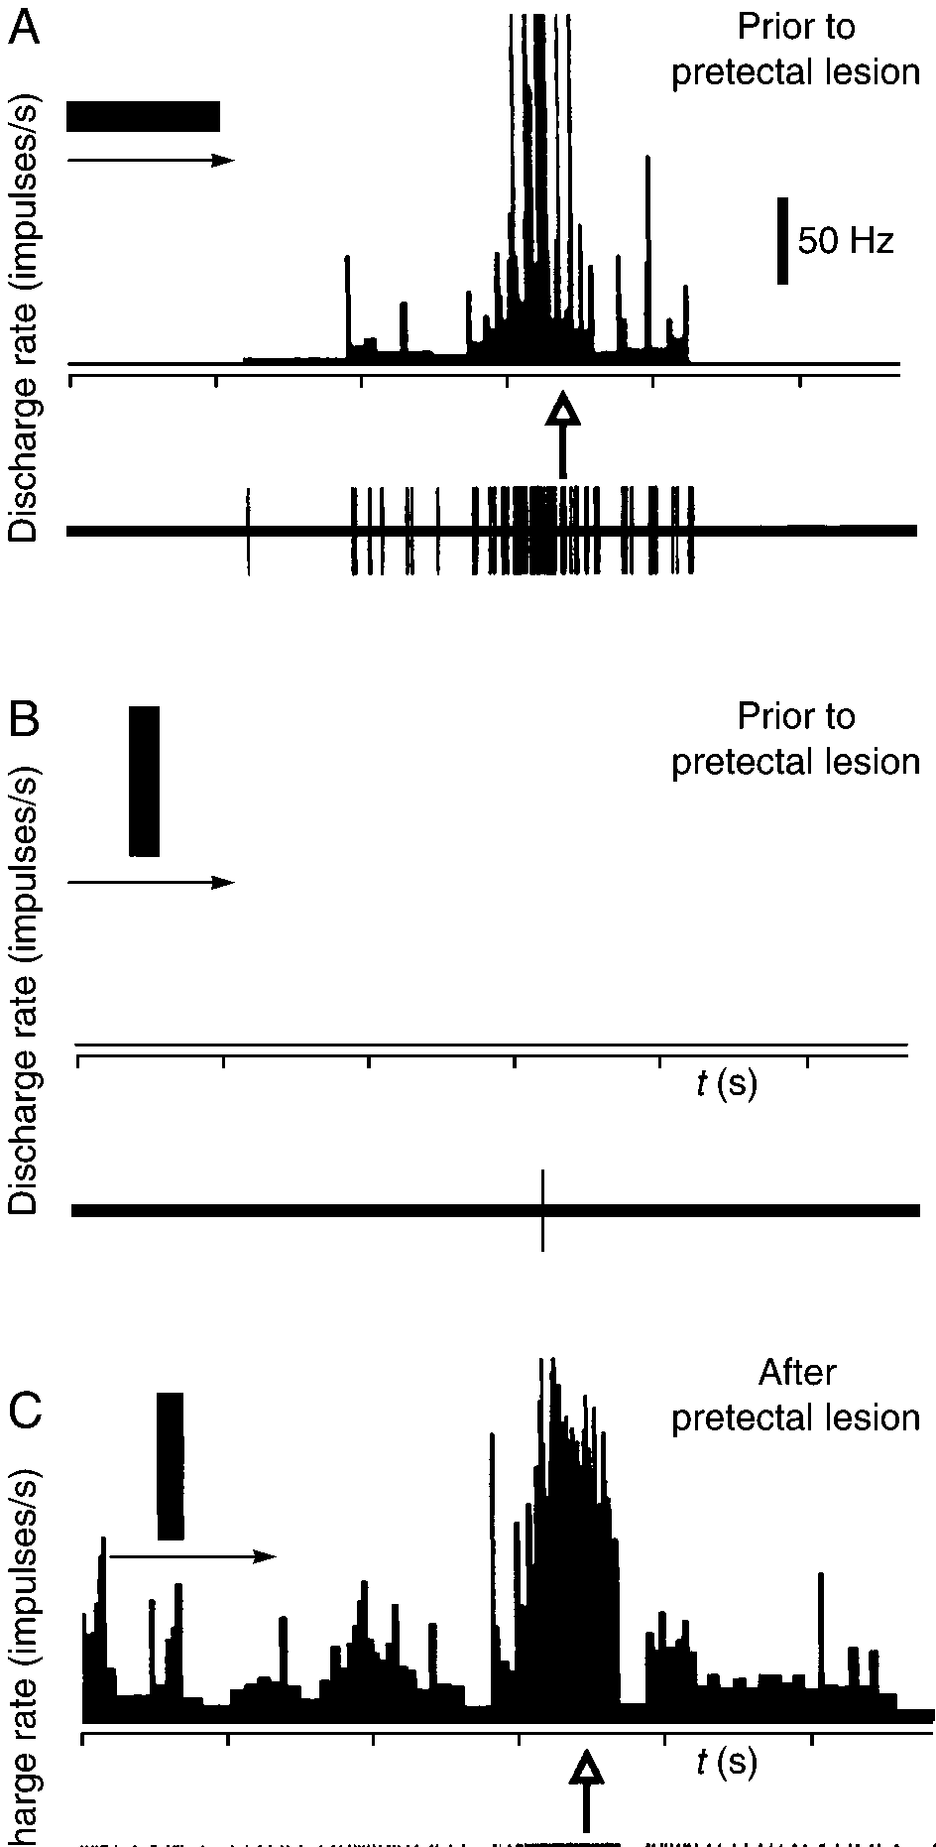
T5.2 activity precedes orienting in freely moving toads
To link neurons to behavior directly, Ewert's group implanted microelectrodes in the tectum of freely moving toads and recorded a T5.2 neuron while bars moved through its receptive field.
A 2.5 × 20 mm bar moving in prey configuration produced a strong burst of spikes that preceded and "predicted" the toad's orienting movement toward the stimulus (arrow). The same bar moving at the same speed in non-prey configuration produced almost no activity, and the toad did not respond.
The coupling between the neuron's burst and the behavior supports the proposal that T5.2 neurons contribute to releasing prey-catching. T5.2 axons run toward the medulla oblongata, so a burst that leads the turn can reach premotor circuits for orienting.
Ewert (1997), Fig. 4A–C. A freely moving toad's T5.2 neuron: bar in prey (A) and non-prey (B) configuration before, and non-prey (C) after a pretectal lesion.
Ewert (1997); Ewert et al. (2001)
17
Notes:
• The strongest link came from recordings in toads that could move freely.
– An electrode in the tectum recorded a T5.2 neuron while a bar moved through its receptive field.
• When the bar moved as a worm, the neuron fired a strong burst, and that burst came just before the toad turned toward it.
– When the same bar moved as an antiworm, the neuron was almost silent and the toad did nothing.
• This ties the neuron's activity to the behavior, though by itself it is a correlation, not proof that the neuron causes the turn.
References:
Ewert JP (1997). Neural correlates of key stimulus and releasing mechanism: a case study and two concepts. Trends in Neurosciences 20(8): 332–339. https://doi.org/10.1016/S0166-2236(96)01042-9
Ewert JP, Buxbaum-Conradi H, Dreisvogt F, Glagow M, Merkel-Harff C, Röttgen A, Schürg-Pfeiffer E, Schwippert WW (2001). Neural modulation of visuomotor functions underlying prey-catching behaviour in anurans: perception, attention, motor performance, learning. Comparative Biochemistry and Physiology A 128: 417–461. https://doi.org/10.1016/S1095-6433(00)00333-0
Figure: Ewert (1997), Fig. 4A–C. A freely moving toad's T5.2 neuron: bar in prey (A) and non-prey (B) configuration before, and non-prey (C) after a pretectal lesion.
Figure source: https://doi.org/10.1016/S0166-2236(96)01042-9

Slide 22
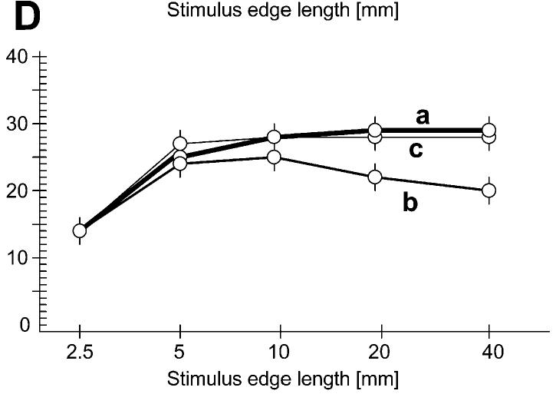
Pretectal lesions abolish the worm–antiworm distinction
After a pretectal lesion delivered through a second implanted electrode, the same T5.2 neuron fired strongly to the non-prey bar, and the toad oriented toward it (Fig. 4C). The neuron's receptive field also enlarged and it developed resting discharge.
In behavior, toads with bilateral pretectal lesions turned toward worms, antiworms and squares at similar rates. Antiworms, which normally abolish turning, became as effective as worms.
Lesioned toads showed a wider syndrome: tectal neurons responded more strongly and to large objects and textures; toads snapped at stationary objects, at targets far out of reach and at self-induced image motion. The pretectum therefore supplies inhibition that sharpens tectal responses.
Ewert et al. (2001), Fig. 2D. Turning to worm (a), antiworm (b) and square (c) stimuli after bilateral pretectal thalamic lesions (n = 20 toads).
Ewert et al. (2001); Ewert (1997)
18
Notes:
• After a lesion of the pretectum, the same T5.2 neuron fired strongly to the antiworm bar, and the toad turned toward it.
– The neuron's receptive field also got bigger and it started firing spontaneously.
• Behaviorally, toads without a pretectum turned toward worms, antiworms and squares about equally.
– The antiworm, normally ignored, became as good as a worm.
• They also snapped at non-moving objects, at things too far away and at image motion caused by their own movement. The pretectum normally provides the inhibition that makes the tectum selective.
References:
Ewert JP, Buxbaum-Conradi H, Dreisvogt F, Glagow M, Merkel-Harff C, Röttgen A, Schürg-Pfeiffer E, Schwippert WW (2001). Neural modulation of visuomotor functions underlying prey-catching behaviour in anurans: perception, attention, motor performance, learning. Comparative Biochemistry and Physiology A 128: 417–461. https://doi.org/10.1016/S1095-6433(00)00333-0
Ewert JP (1997). Neural correlates of key stimulus and releasing mechanism: a case study and two concepts. Trends in Neurosciences 20(8): 332–339. https://doi.org/10.1016/S0166-2236(96)01042-9
Figure: Ewert et al. (2001), Fig. 2D. Turning to worm (a), antiworm (b) and square (c) stimuli after bilateral pretectal thalamic lesions (n = 20 toads).
Figure source: https://doi.org/10.1016/S1095-6433(00)00333-0

Slide 23
Pretectal inhibition subtracts antiworm drive
Tectal selectivity can be read as a balance of two inputs. Retinal excitation reaching T5.2 reports size, contrast and movement without regard to configuration, while pretectal TH3 output grows with extension across the path and cancels the excitation an antiworm brings.
Recording one T5.2 cell before and after the lesion rules out a change in which cells were sampled. Its enlarged field and new resting discharge fit the loss of inhibition that normally trims the field's edges and holds baseline firing low.
For the animal, the pretectum supplies the rejection side of each decision. Lesioned toads still found prey, but recognition failed toward overinclusion, so selectivity here comes largely from suppressing responses to non-prey.
Ewert et al. (2001), Fig. 2D. Turning to worm (a), antiworm (b) and square (c) stimuli after bilateral pretectal thalamic lesions (n = 20 toads).
Ewert (1997); Ewert et al. (2001); Ewert et al. (1978)
18a
Notes:
• Slides 10, 11, 16 and 18 together give a simple causal account of why T5.2 neurons prefer worms: excitation that is blind to configuration, minus inhibition that is not.
• Two inputs with different tuning.
– The retinal classes on slide 10 respond according to size and receptive-field size, and none of them separates worms from antiworms the way behavior does.
– Pretectal TH3 neurons on slides 11 and 16 have negative discriminant values and respond best to large extension across the path.
– When both reach a T5.2 neuron, an antiworm arrives with strong inhibition attached, while a worm arrives with little.
• The within-cell comparison.
– Slides 17 and 18 use the same chronically recorded neuron, with a second implanted electrode used to make the pretectal lesion.
– Comparing a cell with itself removes the worry that lesioned and intact animals simply had different neurons under the electrode.
– The bigger receptive field and the new spontaneous firing are what one expects when an inhibitory surround and tonic inhibition are taken away.
• What this means for the toad.
– A toad without the pretectum is not blind to prey; it over-responds, which tells us that the veto, not the detection, is what was lost.
– Ewert's 2001 review states that prey and non-prey discrimination rests on the interaction of the tectal stream with the pretectal thalamus.
References:
Ewert JP (1997). Neural correlates of key stimulus and releasing mechanism: a case study and two concepts. Trends in Neurosciences 20(8): 332–339. https://doi.org/10.1016/S0166-2236(96)01042-9
Ewert JP, Buxbaum-Conradi H, Dreisvogt F, Glagow M, Merkel-Harff C, Röttgen A, Schürg-Pfeiffer E, Schwippert WW (2001). Neural modulation of visuomotor functions underlying prey-catching behaviour in anurans: perception, attention, motor performance, learning. Comparative Biochemistry and Physiology A 128: 417–461. https://doi.org/10.1016/S1095-6433(00)00333-0
Ewert JP, Borchers HW, von Wietersheim A (1978). Question of prey feature detectors in the toad's Bufo bufo (L.) visual system: a correlation analysis. Journal of Comparative Physiology 126: 43–47. https://doi.org/10.1007/BF01342649

Slide 24
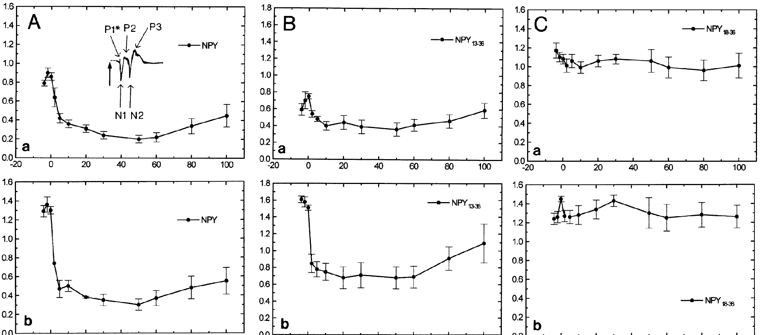
Neuropeptide Y carries pretecto-tectal inhibition
Neuropeptide Y (NPY) is a 36-amino-acid peptide transmitter. NPY-immunoreactive fibers in the superficial tectum originate in ipsilateral pretectal nuclei that match the recording sites of TH3 and TH4 neurons, which project to the tectum.
Schwippert et al. measured the tectal surface field potential in cane toads, evoked by diffuse light-on and light-off, before and after NPY was applied to the tectum. NPY reduced the excitatory N1 wave, which reflects retinal input, by about half within minutes, and the effect lasted more than an hour.
The fragment NPY 13–36, which activates Y2 receptors, had the same effect, whereas NPY 18–36 did not. Y2 receptors are often presynaptic, consistent with the proposal that pretectal NPY reduces transmission from retinal terminals in the tectum.
Ewert et al. (2001), Fig. 5. N1 amplitude of the tectal field potential to light-on (a) and light-off (b) after NPY (A), NPY 13–36 (B) and NPY 18–36 (C).
Ewert et al. (2001); Ewert (1997)
19
Notes:
• Neuropeptide Y is a peptide transmitter used by the pretectal neurons that project to the tectum.
– NPY fibers in the tectum come from the same pretectal areas where TH3 and TH4 neurons are recorded.
• The experiment measured the tectal field potential evoked by turning a light on or off.
– Putting NPY on the tectum cut the first excitatory wave, the retinal input, roughly in half for over an hour.
• A fragment that activates Y2 receptors did the same, and a fragment that does not had no effect.
– Y2 receptors are often on presynaptic terminals, which fits the idea that NPY turns down retinal input to the tectum.
References:
Ewert JP, Buxbaum-Conradi H, Dreisvogt F, Glagow M, Merkel-Harff C, Röttgen A, Schürg-Pfeiffer E, Schwippert WW (2001). Neural modulation of visuomotor functions underlying prey-catching behaviour in anurans: perception, attention, motor performance, learning. Comparative Biochemistry and Physiology A 128: 417–461. https://doi.org/10.1016/S1095-6433(00)00333-0
Ewert JP (1997). Neural correlates of key stimulus and releasing mechanism: a case study and two concepts. Trends in Neurosciences 20(8): 332–339. https://doi.org/10.1016/S0166-2236(96)01042-9
Figure: Ewert et al. (2001), Fig. 5. N1 amplitude of the tectal field potential to light-on (a) and light-off (b) after NPY (A), NPY 13–36 (B) and NPY 18–36 (C).
Figure source: https://doi.org/10.1016/S1095-6433(00)00333-0

Slide 25
NPY scales retinal input before tectal cells see it
A surface field potential is the summed voltage of many synchronously active synapses, so N1 measures how strongly retinal terminals drive the tectum together. Diffuse flashes engage them without any pattern, isolating transmission strength from configuration.
The fragments rule out a general effect of NPY-derived peptides: only the Y2-activating fragment acted. A presynaptic receptor lowers release from the terminal carrying it, scaling retinal input before tectal dendrites receive it.
NPY fibers end mainly in laminae B and C, where R2 axons terminate, so pretectal output is placed to act on the retinal class that responds best to small objects. A depression lasting over an hour fits a brake that sets the tectum's working range across many encounters.
Ewert et al. (2001), Fig. 5. N1 amplitude of the tectal field potential to light-on (a) and light-off (b) after NPY (A), NPY 13–36 (B) and NPY 18–36 (C).
Ewert et al. (2001); Ewert (1997)
19a
Notes:
• The NPY experiment uses a population signal and a pair of peptide fragments, and both choices need explaining before the result can be tied to the anatomy on slide 14.
• What a field potential measures.
– A surface electrode does not see single spikes; it records the summed current of thousands of synapses that are active together.
– Turning a diffuse light on or off activates many retinal terminals at the same moment, so the first wave reflects how much transmitter those terminals release onto the tectum.
• Why two fragments.
– If NPY 13–36 and NPY 18–36 had both worked, the result could reflect some general property of NPY fragments.
– Only the Y2-activating fragment acted, which ties the depression to a receptor type that commonly sits on presynaptic terminals.
– Presynaptic inhibition reduces how much transmitter each incoming spike releases, so the signal is weakened at its source.
• Linking to the laminae.
– Slide 14 places R2 terminals in laminae B and C and the NPY fibers mainly in the same laminae.
– Slide 10 describes R2 cells as responding best to small stimuli, so the pretectal brake is located on the small-object retinal channel.
– The effect on slide 19 lasted more than an hour, much longer than a single prey encounter.
References:
Ewert JP, Buxbaum-Conradi H, Dreisvogt F, Glagow M, Merkel-Harff C, Röttgen A, Schürg-Pfeiffer E, Schwippert WW (2001). Neural modulation of visuomotor functions underlying prey-catching behaviour in anurans: perception, attention, motor performance, learning. Comparative Biochemistry and Physiology A 128: 417–461. https://doi.org/10.1016/S1095-6433(00)00333-0
Ewert JP (1997). Neural correlates of key stimulus and releasing mechanism: a case study and two concepts. Trends in Neurosciences 20(8): 332–339. https://doi.org/10.1016/S0166-2236(96)01042-9

Slide 26
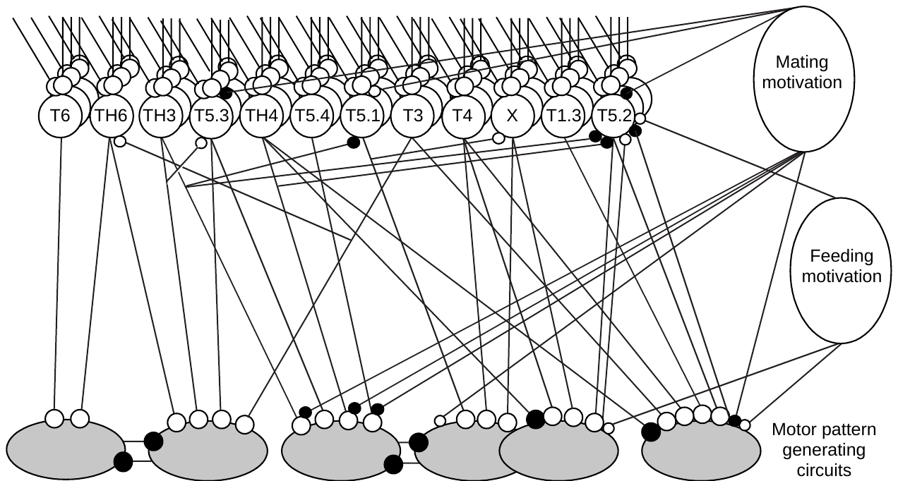
Sensorimotor codes combine many processing streams
Ewert proposed that behavior is released not by single detector neurons but by sensorimotor codes: combinations of activity across distributed processing streams.
At least seven physiologically distinct types of tectal neurons, and several pretectal types, project to the medulla, as shown by antidromic stimulation. Each stream carries information about several stimulus properties (convergence), and each property is represented in several streams (divergence).
Particular combinations activate the motor-pattern circuits for snapping, turning toward prey, avoiding, jumping or ducking. Motivation selects among them: T5.2 responses are very weak in satiated toads during the hunting season and in unfed toads during the mating season, when approach to a mate takes priority.
Ewert (1997), Fig. 5. Combinations of tectal (T) and pretectal (TH) streams, gated by feeding and mating motivation, select motor pattern circuits.
Ewert (1997)
20
Notes:
• Ewert's model replaces a single worm detector with combinations of active neuron types, which he called sensorimotor codes.
– At least seven types of tectal neurons and several pretectal types send axons down to the medulla.
• Each type carries information about several features, and each feature is carried by several types.
– A particular combination activates the motor circuit for snapping, turning, avoiding, jumping or ducking.
• Motivation filters these codes. T5.2 neurons respond weakly in a well-fed toad, and in the mating season, when toads approach mates instead of prey.
References:
Ewert JP (1997). Neural correlates of key stimulus and releasing mechanism: a case study and two concepts. Trends in Neurosciences 20(8): 332–339. https://doi.org/10.1016/S0166-2236(96)01042-9
Figure: Ewert (1997), Fig. 5. Combinations of tectal (T) and pretectal (TH) streams, gated by feeding and mating motivation, select motor pattern circuits.
Figure source: https://doi.org/10.1016/S0166-2236(96)01042-9

Slide 27
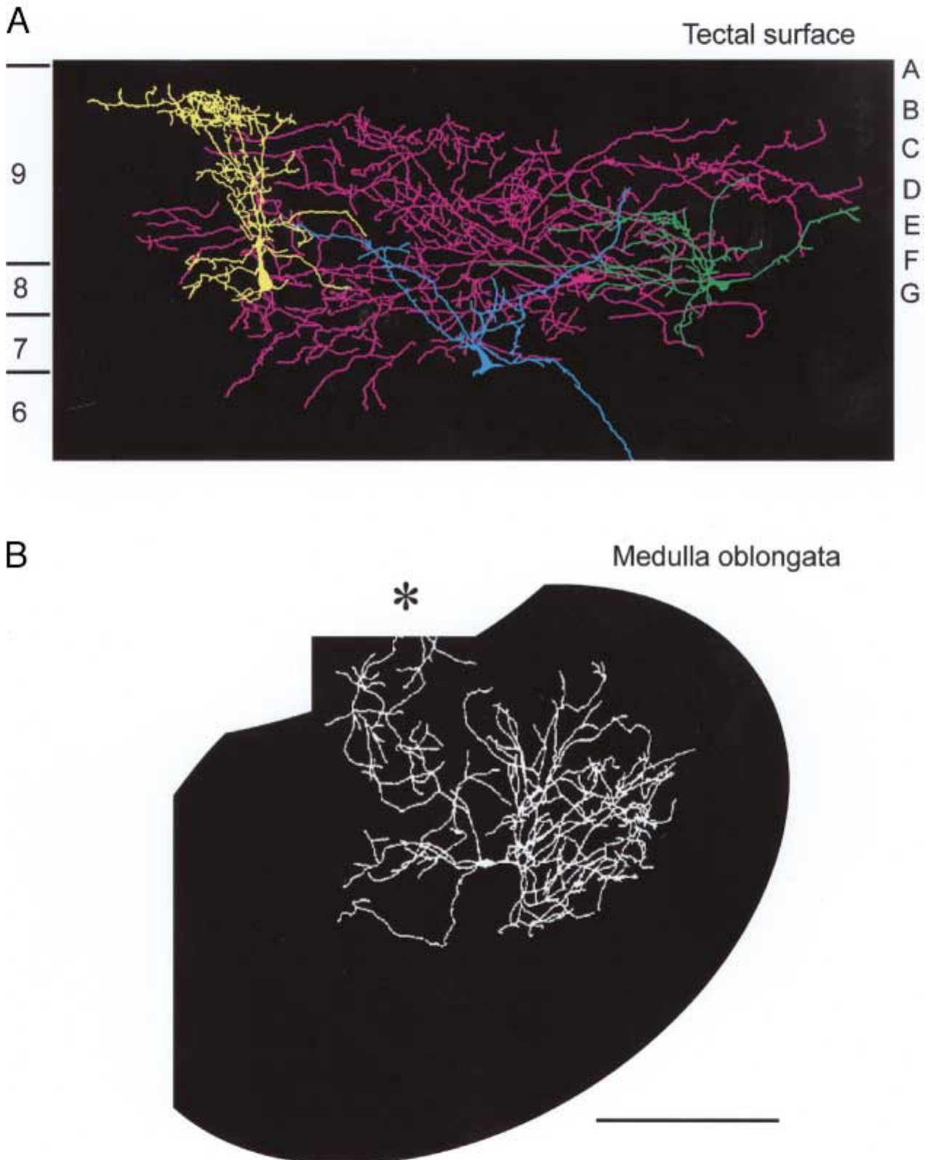
Medullary neurons converge inputs for snapping
Tectal and pretectal projection neurons send axons to premotor and motor structures in the medulla oblongata, the most caudal part of the brainstem.
In the medullary motor nucleus of the trigeminal nerve, which controls the jaw muscles, some neurons respond best to prey-like visual stimuli. A cobalt-filled medullary neuron has a richly branched dendritic tree extending into the lateral and medial reticular formation and into vestibular and spinocerebellar regions.
Such dendritic trees can collect inputs from many descending streams. Ewert suggested that the precise timing of these inputs could allow coincidence detection, binding distributed activity into the command for a ballistic act. Neurophysiological data suggest di- or polysynaptic connections between the tectal snapping-evoking area and medullary motor neurons for snapping.
Ewert (1997), Fig. 2A–B. Tectal neurons converging inputs (A) and a cobalt-filled medullary neuron with dendrites spanning reticular and vestibular regions (B).
Ewert (1997)
21
Notes:
• The final steps happen in the medulla, the lowest part of the brainstem.
– Some neurons in the trigeminal motor nucleus, which drives the jaw muscles, respond best to prey-like visual stimuli.
• This filled medullary neuron has a huge dendritic tree reaching into several brainstem regions.
– That allows it to collect signals from many descending streams at once.
• Ewert suggested that the timing of those inputs, arriving together, could select the motor command. Recordings suggest only one or two synapses between the tectal snapping area and the medullary motor neurons.
References:
Ewert JP (1997). Neural correlates of key stimulus and releasing mechanism: a case study and two concepts. Trends in Neurosciences 20(8): 332–339. https://doi.org/10.1016/S0166-2236(96)01042-9
Figure: Ewert (1997), Fig. 2A–B. Tectal neurons converging inputs (A) and a cobalt-filled medullary neuron with dendrites spanning reticular and vestibular regions (B).
Figure source: https://doi.org/10.1016/S0166-2236(96)01042-9

Slide 28
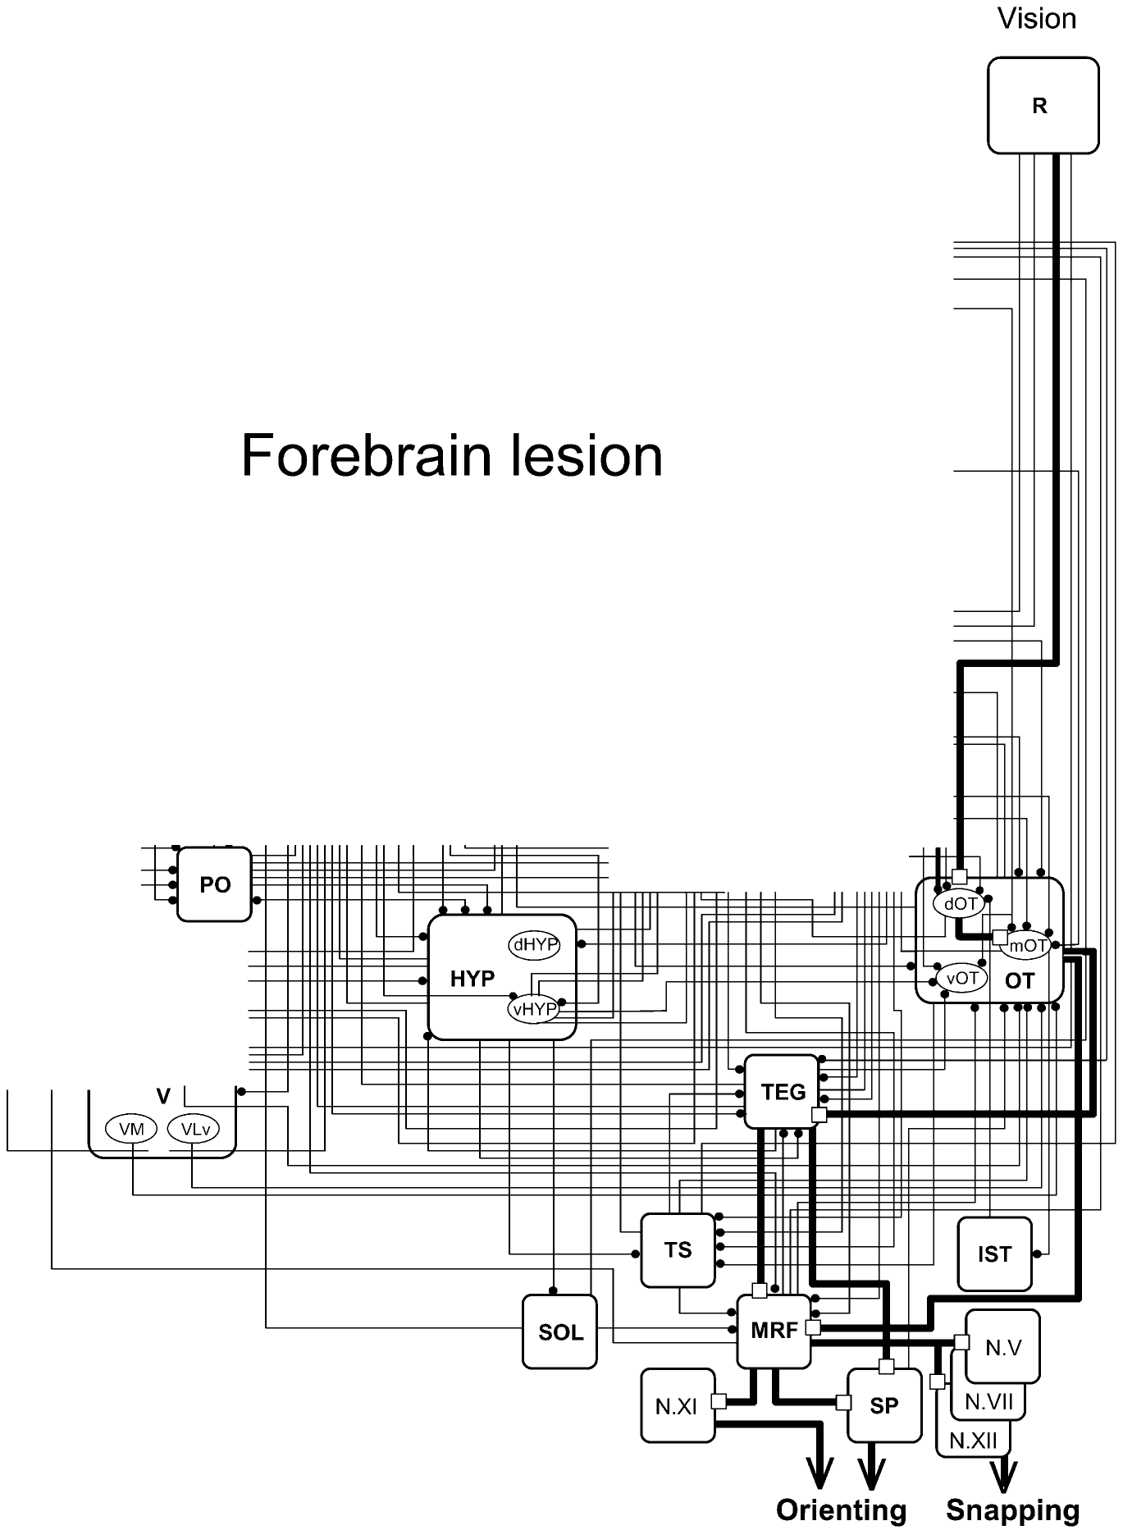
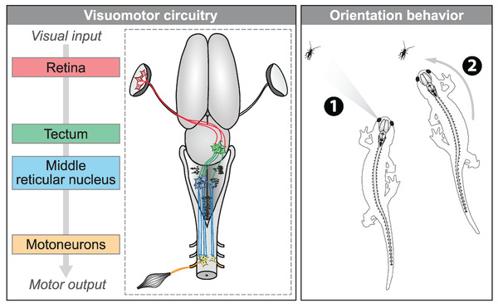
Without forebrain and pretectum, prey-catching is crude
Ewert ablated both telencephalic hemispheres together with the dorsal diencephalon, which contains the pretectum, sparing the eyes, optic chiasm, preoptic area, hypothalamus, pituitary and ventral thalamus. These toads readily oriented and snapped toward moving objects. Removing the telencephalon alone, by contrast, abolished prey orienting.
The remaining retino–tecto/tegmento–bulbar/spinal pathway, from retina to tectum, then through tegmentum and medullary reticular formation (MRF) to spinal and cranial motor nuclei, is therefore sufficient to release orienting and snapping. Without the pretectum, however, any moving image elicited prey-catching, and toads collided with obstacles and misjudged distance.
Flaive and Ryczko traced a homologous route in salamanders, from retina through tectum to reticulospinal neurons of the middle reticular nucleus that steer the body.
Ewert et al. (2001), Fig. 3. Retino–tecto–tegmento–bulbar/spinal pathway (bold) that remains after forebrain lesion.
Flaive & Ryczko (2022), Fig. 8. Salamander visuomotor circuit: retina, tectum, middle reticular nucleus and motoneurons for orienting.
Ewert et al. (2001); Flaive & Ryczko (2022)
22
Notes:
• Two lesions give opposite results.
– Removing only the cerebral hemispheres abolished prey orienting.
– Removing the hemispheres together with the dorsal diencephalon, which includes the pretectum, left toads that readily turned and snapped at moving objects.
• So the core pathway, retina to tectum to tegmentum and medulla to the motor nuclei, is enough to produce turning and snapping.
– But without the pretectum it is indiscriminate: any moving image triggers prey-catching, and the toads bump into obstacles and misjudge distance.
• Flaive and Ryczko found a matching chain in salamanders, from retina through tectum to reticulospinal neurons that steer the body toward prey.
References:
Ewert JP, Buxbaum-Conradi H, Dreisvogt F, Glagow M, Merkel-Harff C, Röttgen A, Schürg-Pfeiffer E, Schwippert WW (2001). Neural modulation of visuomotor functions underlying prey-catching behaviour in anurans: perception, attention, motor performance, learning. Comparative Biochemistry and Physiology A 128: 417–461. https://doi.org/10.1016/S1095-6433(00)00333-0
Flaive A, Ryczko D (2022). From retina to motoneurons: a substrate for visuomotor transformation in salamanders. Journal of Comparative Neurology 530(14): 2518–2536. https://doi.org/10.1002/cne.25348
Figure: Ewert et al. (2001), Fig. 3. Retino–tecto–tegmento–bulbar/spinal pathway (bold) that remains after forebrain lesion.
Figure source: https://doi.org/10.1016/S1095-6433(00)00333-0
Figure: Flaive & Ryczko (2022), Fig. 8. Salamander visuomotor circuit: retina, tectum, middle reticular nucleus and motoneurons for orienting.
Figure source: https://doi.org/10.1002/cne.25348

Slide 29
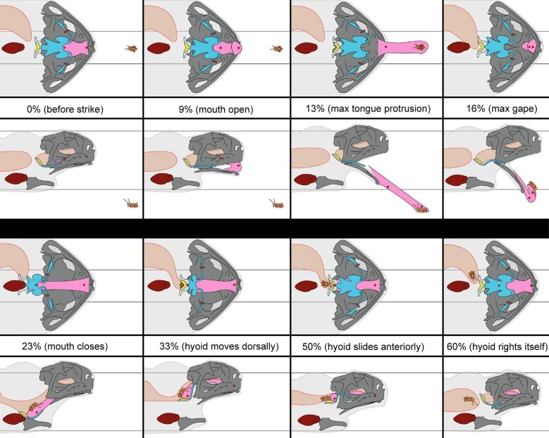
The tongue is flipped out and the hyoid swallows the prey
The consummatory act, snapping, launches the tongue. Keeffe and colleagues used XROMM (X-ray Reconstruction of Moving Morphology), in which radio-opaque markers implanted in skeleton and tongue are tracked in biplanar X-ray video, to follow the cane toad, Rhinella marina, through the feeding cycle.
The mouth opened at about 9% of the cycle, the tongue reached maximal protrusion at 13% and maximal gape at 16%, and the mouth closed with the prey at 23%. During transport and swallowing the hyoid apparatus moved dorsally and anteriorly, and the tongue stretched behind the skull, often more than during protrusion.
Kinematics were similar across individuals, and unsuccessful strikes resembled successful ones, consistent with snapping being a ballistic motor pattern.
Keeffe et al. (2022), Fig. 8. Phases of a cane toad feeding event from X-ray video, ventral and lateral views, with tongue (pink) and hyoid (blue).
Keeffe et al. (2022); Ewert et al. (2001)
23
Notes:
• Snapping is the final act, and Keeffe and colleagues filmed it with X-ray video in the cane toad.
– Markers in the bones and tongue let them reconstruct movements in three dimensions.
• The whole strike is quick and ordered.
– The mouth opens, the tongue is fully out by about 13 percent of the cycle, and the mouth closes on the prey by about 23 percent.
– Then the hyoid, the cartilage frame under the tongue, moves the prey back for swallowing.
• Strikes looked the same from toad to toad, and misses looked like hits, which fits the idea that once launched, the strike runs to completion.
References:
Keeffe R, Blob R, Blackburn D, Mayerl C (2022). XROMM analysis of feeding mechanics in toads: interactions of the tongue, hyoid, and pectoral girdle. Integrative Organismal Biology 4(1): obac045. https://doi.org/10.1093/iob/obac045
Ewert JP, Buxbaum-Conradi H, Dreisvogt F, Glagow M, Merkel-Harff C, Röttgen A, Schürg-Pfeiffer E, Schwippert WW (2001). Neural modulation of visuomotor functions underlying prey-catching behaviour in anurans: perception, attention, motor performance, learning. Comparative Biochemistry and Physiology A 128: 417–461. https://doi.org/10.1016/S1095-6433(00)00333-0
Figure: Keeffe et al. (2022), Fig. 8. Phases of a cane toad feeding event from X-ray video, ventral and lateral views, with tongue (pink) and hyoid (blue).
Figure source: https://doi.org/10.1093/iob/obac045

Slide 30
Snapping runs open-loop, so aiming happens first
A closed-loop movement is corrected by sensory feedback while it runs; an open-loop or ballistic movement is fully specified before it starts. Among the acts of the catching sequence, the snap is the clearest open-loop case.
In the cane toad the eyes close at the start of the feeding cycle and reopen around the time the mouth shuts on the prey, while the tongue reaches full protrusion from rest in about 46 ms. Vision is unavailable during the strike, and the tongue, flipped out largely under its own inertia, follows a path set at launch.
Accuracy must therefore come first. Binocular fixation measures direction and distance, and medullary neurons that gather many descending streams could release the snap only when those signals coincide. Zebrafish larvae likewise converge their eyes before the capture swim.
Keeffe et al. (2022), Fig. 8. Phases of a cane toad feeding event from X-ray video, ventral and lateral views, with tongue (pink) and hyoid (blue).
Keeffe et al. (2022); Ewert (1997); Bianco et al. (2011)
23a
Notes:
• The XROMM data explain why the toad's catching sequence puts fixation before snapping, and why misses look like hits.
• Two kinds of movement control.
– In a closed-loop movement, the senses keep reporting and the movement is adjusted on the way.
– In an open-loop movement, the nervous system computes the whole command in advance, and the movement then runs to completion.
• The evidence from the strike itself.
– Keeffe and colleagues found that their toads consistently closed their eyes during the prey capture phase, with closure beginning at the start of the cycle.
– Tongue tip protrusion from rest took about 46 milliseconds, and in frogs the tongue is flipped forward largely by inertia, so there is neither visual input nor time for correction.
• Where accuracy comes from.
– Slide 2 places binocular fixation immediately before the snap, which is where direction and distance must be settled.
– Slide 21 describes medullary neurons whose dendrites collect many descending streams, and Ewert suggested that coincident input selects the ballistic command.
– Slide 37 gives the same order in zebrafish, where eye convergence enlarges the binocular field before the strike.
References:
Keeffe R, Blob R, Blackburn D, Mayerl C (2022). XROMM analysis of feeding mechanics in toads: interactions of the tongue, hyoid, and pectoral girdle. Integrative Organismal Biology 4(1): obac045. https://doi.org/10.1093/iob/obac045
Ewert JP (1997). Neural correlates of key stimulus and releasing mechanism: a case study and two concepts. Trends in Neurosciences 20(8): 332–339. https://doi.org/10.1016/S0166-2236(96)01042-9
Bianco IH, Kampff AR, Engert F (2011). Prey capture behavior evoked by simple visual stimuli in larval zebrafish. Frontiers in Systems Neuroscience 5: 101. https://doi.org/10.3389/fnsys.2011.00101

Slide 31
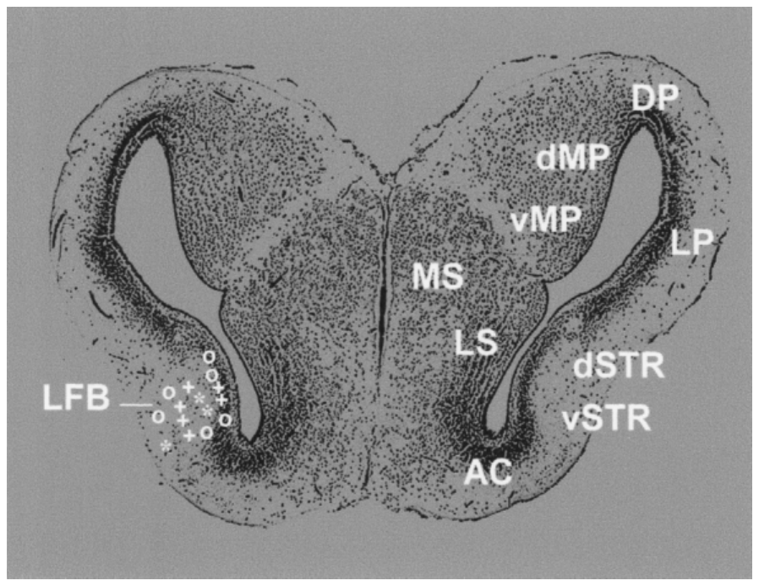
Visual neurons in the caudal ventral striatum
The amphibian striatum is homologous to part of the basal ganglia of amniotes, which in mammals participate in initiating and controlling orienting responses. Small lesions of the toad's caudal striatum, but not of the ventral medial pallium, produced prey neglect: visually guided prey-catching decreased.
Electrical stimulation of the striatum in freely moving toads did not elicit orienting, but it facilitated orienting toward a subliminal prey stimulus. There was even a retinotopic relation between stimulation sites and the parts of the visual field in which orienting was facilitated.
Buxbaum-Conradi and Ewert recorded visually responsive neurons in the cane toad's caudal ventral striatum. Their recording sites (symbols) extended from the striatal gray matter into the lateral forebrain bundle.
Ewert et al. (2001), Fig. 6. Recording sites of visually responsive striatal neurons (symbols) on a transverse section of the cane toad telencephalon.
Ewert et al. (2001)
24
Notes:
• The striatum in amphibians corresponds to part of the mammalian basal ganglia, which help start orienting movements.
– Small lesions of the toad's caudal striatum produced prey neglect, a drop in prey-catching.
• Stimulating the striatum did not cause turning by itself, but it made the toad more likely to turn toward a weak prey stimulus.
– The effect was even mapped to parts of the visual field, depending on where the electrode was.
• Recordings found visually responsive neurons in the caudal ventral striatum, marked by the symbols on this section.
References:
Ewert JP, Buxbaum-Conradi H, Dreisvogt F, Glagow M, Merkel-Harff C, Röttgen A, Schürg-Pfeiffer E, Schwippert WW (2001). Neural modulation of visuomotor functions underlying prey-catching behaviour in anurans: perception, attention, motor performance, learning. Comparative Biochemistry and Physiology A 128: 417–461. https://doi.org/10.1016/S1095-6433(00)00333-0
Figure: Ewert et al. (2001), Fig. 6. Recording sites of visually responsive striatal neurons (symbols) on a transverse section of the cane toad telencephalon.
Figure source: https://doi.org/10.1016/S1095-6433(00)00333-0

Slide 32
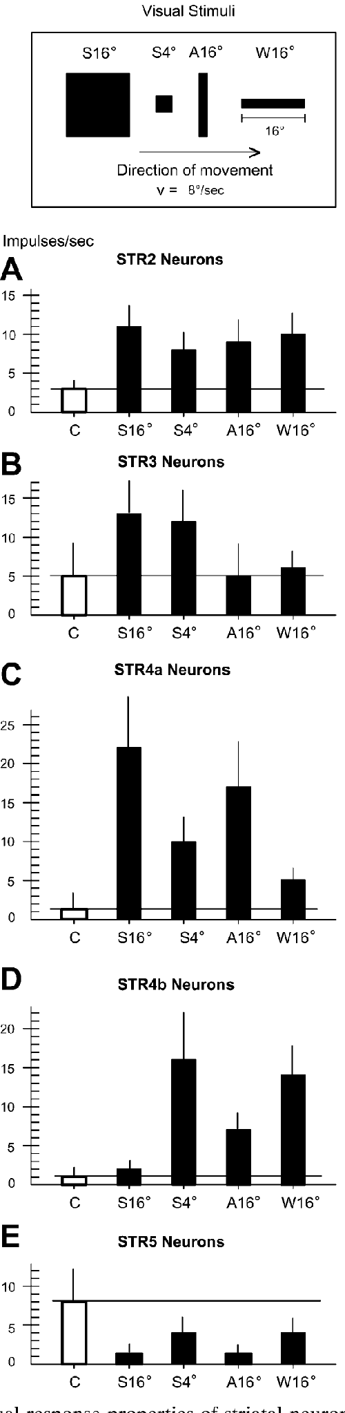
Striatal neurons signal motion, prey and threat
Buxbaum-Conradi and Ewert classified striatal neurons by their responses to a large square (S16°), a small square (S4°), an antiworm (A16°) and a worm (W16°).
STR2 neurons (about 32%) increased firing to any moving stimulus, behaving like motion detectors. STR3 neurons (15%) preferred moving squares. STR4a neurons responded well to the large threatening square, and STR4b neurons preferred prey-like worms and small squares. STR5 neurons (15%) had resting activity that was reduced by moving stimuli, especially threat. STR1 neurons were uninfluenced.
The receptive fields of these neurons covered the whole visual field of the opposite eye or both eyes, and most habituated to repeated stimulation. Antidromic stimulation showed that striatal output in the lateral forebrain bundle is carried mainly by motion detectors and compact-object neurons.
Ewert et al. (2001), Fig. 7. Firing of STR2, STR3, STR4a, STR4b and STR5 neurons to a large square (S16°), small square (S4°), antiworm (A16°) and worm (W16°).
Ewert et al. (2001)
25
Notes:
• Striatal neurons fell into several types depending on what moving stimuli excited them.
– About a third, STR2, fired to any moving object, like motion detectors.
– STR3 preferred squares, STR4a responded to a large threatening square, and STR4b preferred worm-like prey.
• STR5 neurons had ongoing activity that moving stimuli, especially threats, turned down.
• Their receptive fields covered the whole visual field, and most stopped responding with repetition.
– This looks less like detailed shape analysis and more like signaling that something relevant has appeared, which fits a role in attention.
References:
Ewert JP, Buxbaum-Conradi H, Dreisvogt F, Glagow M, Merkel-Harff C, Röttgen A, Schürg-Pfeiffer E, Schwippert WW (2001). Neural modulation of visuomotor functions underlying prey-catching behaviour in anurans: perception, attention, motor performance, learning. Comparative Biochemistry and Physiology A 128: 417–461. https://doi.org/10.1016/S1095-6433(00)00333-0
Figure: Ewert et al. (2001), Fig. 7. Firing of STR2, STR3, STR4a, STR4b and STR5 neurons to a large square (S16°), small square (S4°), antiworm (A16°) and worm (W16°).
Figure source: https://doi.org/10.1016/S1095-6433(00)00333-0

Slide 33
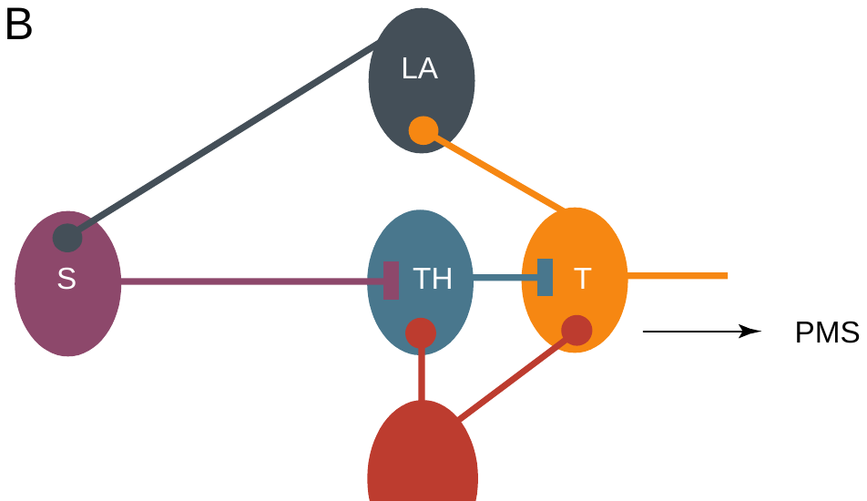
A striato-pretecto-tectal loop gates prey-catching
Ewert proposed a gating loop for directed attention, the translation of prey recognition into action. Retinal output reaches both tectum (T) and pretectum (TH), and pretecto-tectal inhibition distinguishes prey from non-prey.
The striatum (S) receives tectal visual information through the lateral anterior thalamic nucleus (LA). It projects through the lateral forebrain bundle, which contains enkephalinergic fibers, to the pretectum, where it inhibits pretectal neurons. By reducing pretecto-tectal inhibition, the striatum disinhibits the tectum and releases tectal output to the motor systems.
This model explains both lesion results: without the striatum, unopposed pretectal inhibition overrides tectal responses and prey-catching fails; without the pretectum, the tectum is released indiscriminately. In the intact toad, partial inhibition allows a cautious approach.
Ewert (1997), Fig. 1B. Gating loop: striatum (S) receives tectal (T) input via lateral anterior thalamus (LA) and inhibits pretectum (TH), which inhibits tectum.
Ewert (1997); Ewert et al. (2001)
26
Notes:
• Ewert's gating loop ties the forebrain to the tectum.
– The tectum's visual information reaches the striatum through the lateral anterior thalamus.
– The striatum projects back to the pretectum and inhibits it.
• Because the pretectum inhibits the tectum, inhibiting the pretectum releases the tectum, which is disinhibition.
– A recognized prey can then trigger orienting.
• This explains both lesions. Without the striatum, the pretectum's inhibition wins and prey-catching fails; without the pretectum, the tectum responds to everything.
References:
Ewert JP (1997). Neural correlates of key stimulus and releasing mechanism: a case study and two concepts. Trends in Neurosciences 20(8): 332–339. https://doi.org/10.1016/S0166-2236(96)01042-9
Ewert JP, Buxbaum-Conradi H, Dreisvogt F, Glagow M, Merkel-Harff C, Röttgen A, Schürg-Pfeiffer E, Schwippert WW (2001). Neural modulation of visuomotor functions underlying prey-catching behaviour in anurans: perception, attention, motor performance, learning. Comparative Biochemistry and Physiology A 128: 417–461. https://doi.org/10.1016/S1095-6433(00)00333-0
Figure: Ewert (1997), Fig. 1B. Gating loop: striatum (S) receives tectal (T) input via lateral anterior thalamus (LA) and inhibits pretectum (TH), which inhibits tectum.
Figure source: https://doi.org/10.1016/S0166-2236(96)01042-9

Slide 34
Disinhibition permits orienting without driving it
Disinhibition is excitation by removal: when one inhibitory neuron silences another, the final target is freed to respond to excitation it already receives. The striatal signal is therefore permissive; the content passing the gate comes from retinal input about prey.
Striatal stimulation alone produced no turn, as an open gate with no prey behind it releases nothing; paired with a subliminal prey stimulus, it made orienting likely. The retinotopic match between stimulation site and facilitated field position fits a release of inhibition confined to one part of the tectal map.
Fields spanning the whole visual field and responses that fade with repetition suit a signal that something relevant has appeared, not what it is. The tectum and pretectum analyze configuration; the striatal loop decides whether that analysis reaches the motor systems.
Ewert (1997), Fig. 1B. Gating loop: striatum (S) receives tectal (T) input via lateral anterior thalamus (LA) and inhibits pretectum (TH), which inhibits tectum.
Ewert (1997); Ewert et al. (2001)
26a
Notes:
• The gating loop on slide 26 makes specific predictions about what striatal activity can and cannot do, and the stimulation data on slide 24 match them.
• Permissive versus instructive.
– An instructive signal tells a circuit what to do; a permissive signal only allows a circuit to act on information it already has.
– Inhibiting the pretectum removes a brake from the tectum, but if no prey is exciting the tectum, removing the brake changes nothing.
• Reading the stimulation experiment.
– On slide 24, striatal stimulation by itself did not produce orienting, which is exactly the permissive prediction.
– When a weak prey stimulus was also present, the same stimulation facilitated orienting, and the facilitated region of the visual field depended on the stimulation site.
• What striatal neurons report.
– Slide 25 describes striatal neurons with very large receptive fields that habituate, many of them simple motion detectors.
– These are poor properties for identifying objects but good ones for flagging that an object is worth attending to.
– Ewert's 2001 review connects the ventral striatum to directed attention on the basis of these response properties.
References:
Ewert JP (1997). Neural correlates of key stimulus and releasing mechanism: a case study and two concepts. Trends in Neurosciences 20(8): 332–339. https://doi.org/10.1016/S0166-2236(96)01042-9
Ewert JP, Buxbaum-Conradi H, Dreisvogt F, Glagow M, Merkel-Harff C, Röttgen A, Schürg-Pfeiffer E, Schwippert WW (2001). Neural modulation of visuomotor functions underlying prey-catching behaviour in anurans: perception, attention, motor performance, learning. Comparative Biochemistry and Physiology A 128: 417–461. https://doi.org/10.1016/S1095-6433(00)00333-0

Slide 35
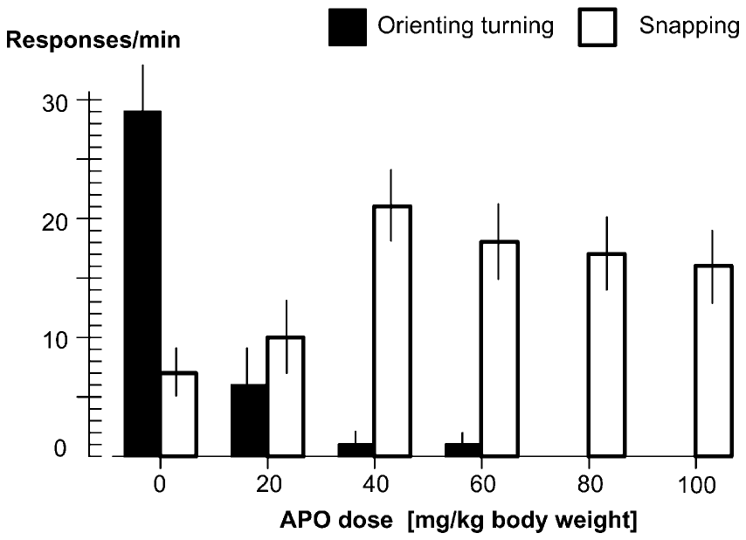
Apomorphine shifts toads from hunting to waiting
Apomorphine (APO) is an agonist at dopamine D1 and D2 receptors. Glagow and Ewert injected it into the lymph sac of common toads and measured prey-catching 20 min later.
As the dose increased, prey-oriented turning fell from about 29 to near zero responses per minute, while snapping rose from about 7 to about 20. Toads that had been hunting sat motionless and "watched" for prey, snapping at items that came close: a shift from a hunting strategy to a waiting strategy, like that of Rana.
The basic pattern of prey discrimination was maintained, but its acuity dropped because of the low snapping threshold. Effects peaked 15–35 min after injection; after 70–90 min turning returned with a short rebound. Pretreatment with the D2 antagonist haloperidol prevented the APO effects.
Ewert et al. (2001), Fig. 9. Prey-oriented turning (black) and snapping (white) per minute 20 min after apomorphine at 0–100 mg/kg (n = 15 toads).
Ewert et al. (2001)
27
Notes:
• Apomorphine activates dopamine receptors, and it changed how toads hunt.
– With higher doses, turning toward prey dropped to almost nothing, while snapping roughly tripled.
• The toads stopped pursuing and sat still, snapping at anything that came close.
– That is a switch from an active hunting strategy to a sit-and-wait strategy, like the frog's.
• They still preferred prey-like objects, but less sharply. The effect peaked 15 to 35 minutes after injection, and haloperidol, which blocks D2 receptors, prevented it.
References:
Ewert JP, Buxbaum-Conradi H, Dreisvogt F, Glagow M, Merkel-Harff C, Röttgen A, Schürg-Pfeiffer E, Schwippert WW (2001). Neural modulation of visuomotor functions underlying prey-catching behaviour in anurans: perception, attention, motor performance, learning. Comparative Biochemistry and Physiology A 128: 417–461. https://doi.org/10.1016/S1095-6433(00)00333-0
Figure: Ewert et al. (2001), Fig. 9. Prey-oriented turning (black) and snapping (white) per minute 20 min after apomorphine at 0–100 mg/kg (n = 15 toads).
Figure source: https://doi.org/10.1016/S1095-6433(00)00333-0

Slide 36
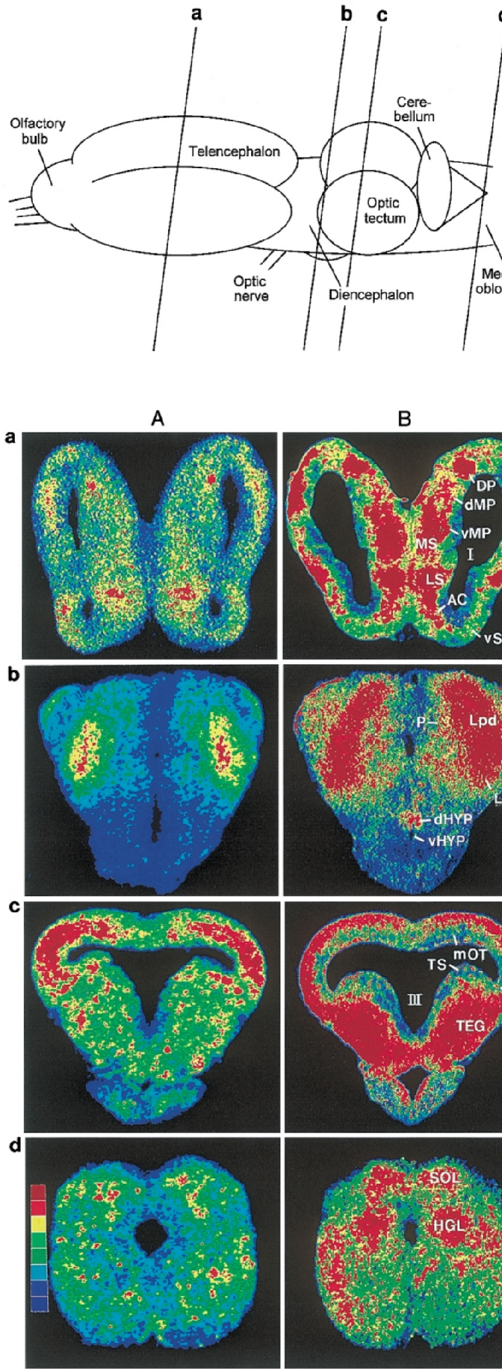
Apomorphine changes glucose use across the toad brain
The ¹⁴C-2-deoxyglucose (2DG) method measures local glucose utilization: 2DG is taken up like glucose but trapped in active cells, and autoradiography maps its accumulation in brain sections.
Glagow and Ewert compared APO-treated and untreated toads, both shown a moving prey-like stimulus, across 41 brain structures. In APO-treated toads, 2DG uptake increased in retinal projection fields, the dorsal tectal layers, pretectal Lpd and anterior thalamus. It decreased in the medial tectal layers, which contain T5.1 and T5.2 output neurons.
Uptake also rose in structures for snapping (medial reticular formation, hypoglossal nucleus) and in mesolimbic and limbic structures (nucleus accumbens, ventral tegmentum, ventral medial pallium, medial septum). These changes match the distribution of dopaminergic cells and fibers in the anuran brain.
Ewert et al. (2001), Fig. 10. Color-coded 2DG uptake in transverse sections (a–d) of an untreated (A) and an apomorphine-treated (B) toad; blue low, red high.
Ewert et al. (2001)
28
Notes:
• The 2-deoxyglucose method shows which brain regions are working harder.
– The tracer is taken up like glucose but gets trapped in active cells, so autoradiography of brain sections maps activity, from blue for low to red for high.
• Apomorphine raised activity in the areas that receive retinal input, including the pretectum, and lowered it in the deep tectal layers that hold the output neurons.
– That fits stronger pretectal inhibition and weaker tectal output for turning.
• Activity also rose in snapping circuits in the medulla and in limbic and mesolimbic structures, all regions with dopamine fibers.
References:
Ewert JP, Buxbaum-Conradi H, Dreisvogt F, Glagow M, Merkel-Harff C, Röttgen A, Schürg-Pfeiffer E, Schwippert WW (2001). Neural modulation of visuomotor functions underlying prey-catching behaviour in anurans: perception, attention, motor performance, learning. Comparative Biochemistry and Physiology A 128: 417–461. https://doi.org/10.1016/S1095-6433(00)00333-0
Figure: Ewert et al. (2001), Fig. 10. Color-coded 2DG uptake in transverse sections (a–d) of an untreated (A) and an apomorphine-treated (B) toad; blue low, red high.
Figure source: https://doi.org/10.1016/S1095-6433(00)00333-0

Slide 37
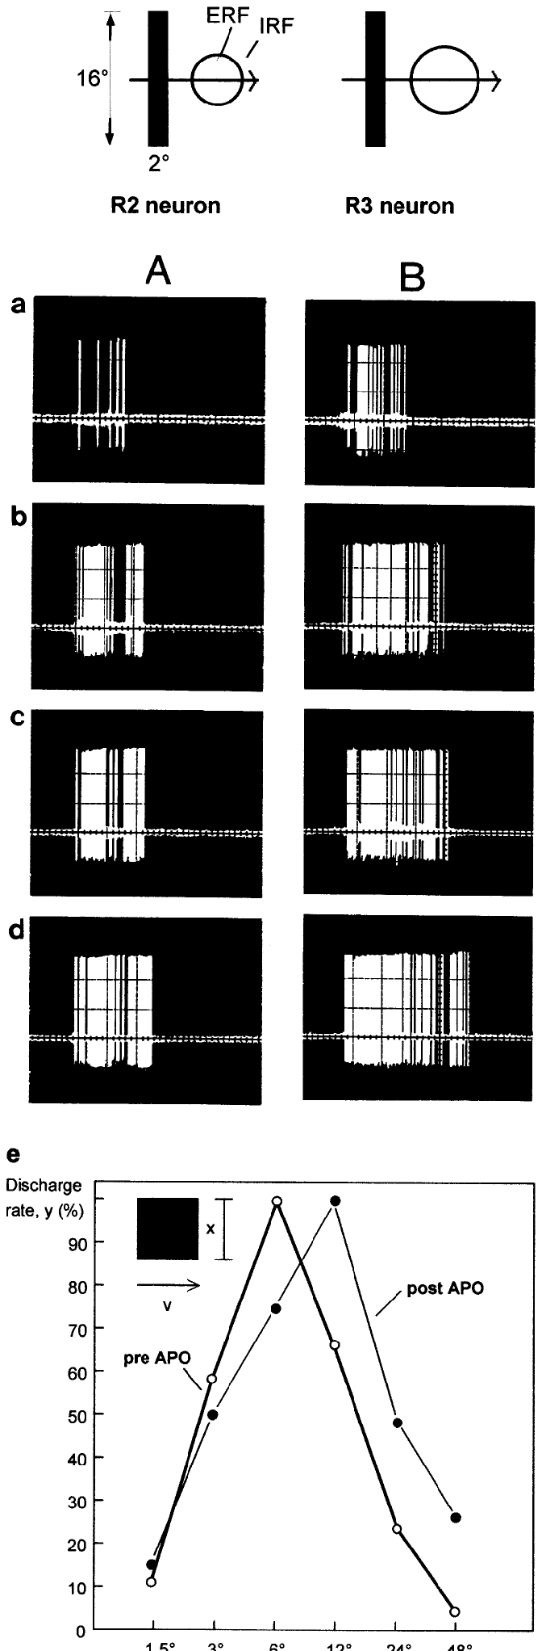
Dopamine enlarges retinal receptive fields
Glagow and Ewert recorded single retinal ganglion cell fibers in the tectum before and after APO, using a 2° × 16° bar moving across the receptive field in antiworm orientation.
R2 neurons (excitatory receptive field 6°) and R3 neurons (8°) fired strongly increasing discharge 10–25 min after APO. In R2 neurons, the size-tuning curve shifted: the stimulus size that drove the strongest response moved from 6° before APO to about 12° after APO, so the excitatory receptive field diameter roughly doubled.
In the retina, dopamine uncouples the gap junctions of horizontal cells, which carry the inhibitory surround. Weakening the surround is consistent with larger excitatory fields and greater retinal output. Ewert et al. proposed that this enhanced retinal input drives the pretectal inhibition that reduces tectal output.
Ewert et al. (2001), Fig. 12. R2 (A) and R3 (B) discharges before (a) and 10–25 min after apomorphine (b–d); (e) R2 size tuning before and after.
Ewert et al. (2001)
29
Notes:
• Recordings from retinal ganglion cells showed that apomorphine made them more active.
– The same bar drove much more firing 10 to 25 minutes after the drug.
• The receptive fields also grew.
– For R2 cells, the best stimulus size moved from about 6 degrees to about 12 degrees, so the excitatory field roughly doubled.
• Dopamine in the retina uncouples the horizontal cells that create the inhibitory surround, which fits larger excitatory fields. More retinal input then feeds more pretectal inhibition onto the tectum.
References:
Ewert JP, Buxbaum-Conradi H, Dreisvogt F, Glagow M, Merkel-Harff C, Röttgen A, Schürg-Pfeiffer E, Schwippert WW (2001). Neural modulation of visuomotor functions underlying prey-catching behaviour in anurans: perception, attention, motor performance, learning. Comparative Biochemistry and Physiology A 128: 417–461. https://doi.org/10.1016/S1095-6433(00)00333-0
Figure: Ewert et al. (2001), Fig. 12. R2 (A) and R3 (B) discharges before (a) and 10–25 min after apomorphine (b–d); (e) R2 size tuning before and after.
Figure source: https://doi.org/10.1016/S1095-6433(00)00333-0

Slide 38
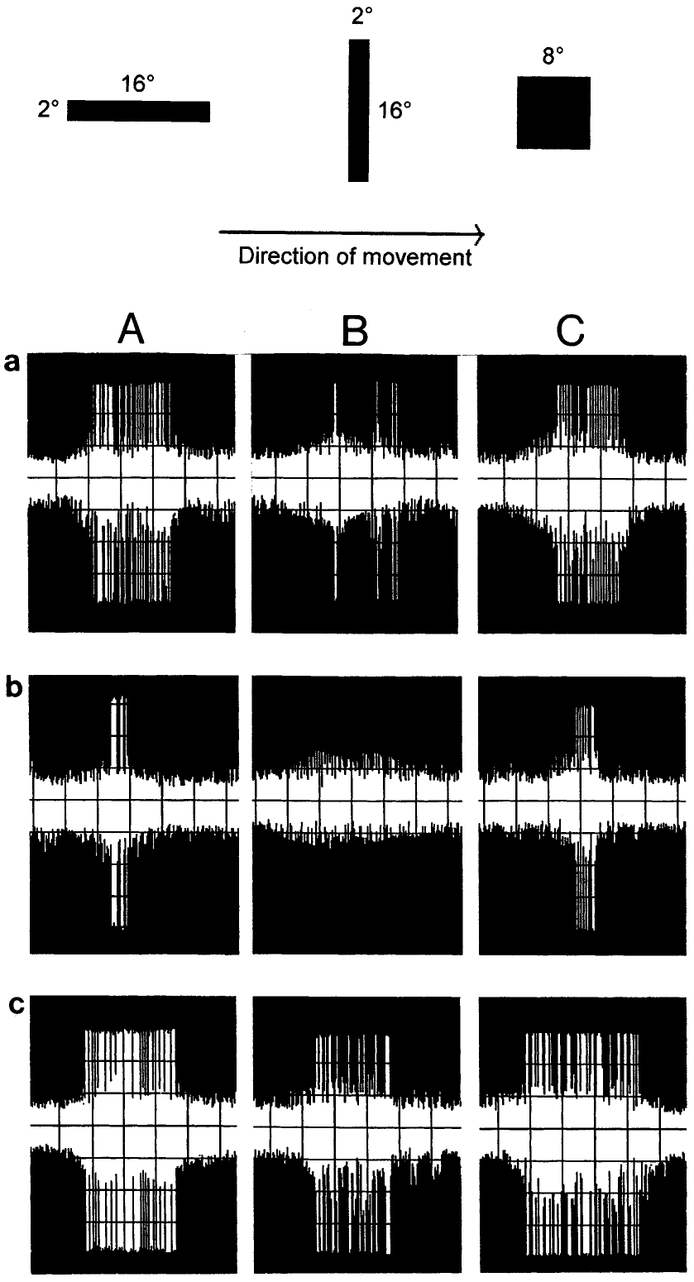
Apomorphine lowers T5.2 output but keeps its preference
At 35 min after APO, the tectal reduction phase, prey-selective T5.2 neurons fired less to a worm bar (A), an antiworm bar (B) and an 8° square (C), even though their retinal input had increased. T5.1 neurons were reduced as well. Their configurational preference was preserved: the worm still drove more spikes than the antiworm.
At about 75 min, during the tectal rebound phase, T5.2 responses increased again, matching the return of orienting behavior.
The reduction in T5.2 firing parallels the drop in prey-oriented turning, and the medial tectal layers containing these output neurons showed lower 2DG uptake. Ewert et al. proposed that APO-enhanced pretectal activity, from TH3 and TH4 neurons whose responses rose under APO, suppresses tectal output to the orienting circuits.
Ewert et al. (2001), Fig. 13. A T5.2 neuron's responses to worm (A), antiworm (B) and square (C) before (a), 35 min (b) and 75 min (c) after apomorphine.
Ewert et al. (2001)
30
Notes:
• Thirty-five minutes after apomorphine, T5.2 neurons fired less to all stimuli, even though their retinal input was larger.
– They still preferred the worm over the antiworm.
• By about 75 minutes their responses came back, at the same time as turning behavior returned.
• The time course matches behavior: less tectal output, less turning. Pretectal TH3 and TH4 neurons fired more under apomorphine, which fits the idea that extra pretectal inhibition reduces tectal output.
References:
Ewert JP, Buxbaum-Conradi H, Dreisvogt F, Glagow M, Merkel-Harff C, Röttgen A, Schürg-Pfeiffer E, Schwippert WW (2001). Neural modulation of visuomotor functions underlying prey-catching behaviour in anurans: perception, attention, motor performance, learning. Comparative Biochemistry and Physiology A 128: 417–461. https://doi.org/10.1016/S1095-6433(00)00333-0
Figure: Ewert et al. (2001), Fig. 13. A T5.2 neuron's responses to worm (A), antiworm (B) and square (C) before (a), 35 min (b) and 75 min (c) after apomorphine.
Figure source: https://doi.org/10.1016/S1095-6433(00)00333-0

Slide 39
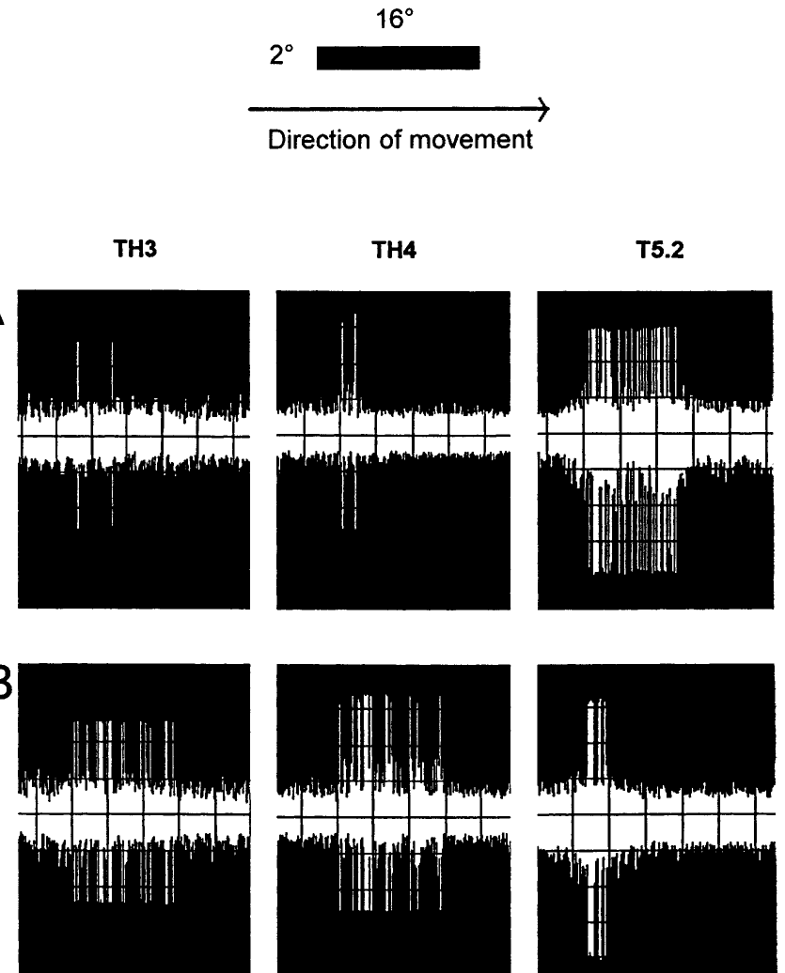
Apomorphine boosts pretectal TH3 and TH4 responses
Glagow and Ewert recorded pretectal TH3 and TH4 neurons, whose axons project to the tectum, and compared them with a tectal T5.2 neuron in the same stimulus condition: a 2° × 16° bar moving at 10°/s in prey configuration.
Before APO, TH3 and TH4 neurons responded only weakly to the prey-configured bar, while the T5.2 neuron responded strongly. About 35 min after APO, TH3 and TH4 discharges to the same bar increased markedly, and the T5.2 neuron's response decreased.
The opposite changes in pretectal and tectal neurons fit the gating model: dopaminergic enhancement of retinal input increases pretecto-tectal inhibition, reducing tectal output for prey-oriented turning. Striatal disinhibition of the pretectum may also be weakened under APO, which would act in the same direction.
Ewert et al. (2001), Fig. 14. Responses of pretectal TH3, TH4 and tectal T5.2 neurons to a prey-configured bar before (A) and 35 min after apomorphine (B).
Ewert et al. (2001)
31
Notes:
• This recording compared pretectal TH3 and TH4 neurons with a tectal T5.2 neuron, all shown the same prey-like bar.
– Before the drug, the pretectal neurons barely responded and the T5.2 neuron responded strongly.
• After apomorphine, the pretectal neurons fired much more and the T5.2 neuron fired less.
– The pretectum gets stronger while the tectum gets weaker.
• That fits the gating model: more retinal input drives more pretectal inhibition, which turns down the tectal output for turning toward prey.
References:
Ewert JP, Buxbaum-Conradi H, Dreisvogt F, Glagow M, Merkel-Harff C, Röttgen A, Schürg-Pfeiffer E, Schwippert WW (2001). Neural modulation of visuomotor functions underlying prey-catching behaviour in anurans: perception, attention, motor performance, learning. Comparative Biochemistry and Physiology A 128: 417–461. https://doi.org/10.1016/S1095-6433(00)00333-0
Figure: Ewert et al. (2001), Fig. 14. Responses of pretectal TH3, TH4 and tectal T5.2 neurons to a prey-configured bar before (A) and 35 min after apomorphine (B).
Figure source: https://doi.org/10.1016/S1095-6433(00)00333-0

Slide 40
Dopamine splits orienting from snapping
Apomorphine moved two acts of one sequence in opposite directions. Turning fell with tectal T5.2 output, while snapping rose together with glucose use in the hypoglossal nucleus, which drives the tongue, and the medial reticular formation. One drug can raise one act and lower another only when different circuits carry them.
The drugged toad matches the frog in two ways: little orienting with frequent snaps at nearby items, and broader acceptance of non-prey. With a lower snapping threshold, weaker stimuli reach the strike, flattening discrimination while its basic shape survives.
In Ewert's interpretation, dopamine sets hunting strategy rather than switching feeding on or off. T5.2 still prefers worms, while priority shifts between motor channels: pursuit when tectal orienting output is high, waiting and snapping when it is suppressed.
Ewert et al. (2001), Fig. 10. Color-coded 2DG uptake in transverse sections (a–d) of an untreated (A) and an apomorphine-treated (B) toad; blue low, red high.
Ewert et al. (2001); Schürg-Pfeiffer & Ewert (1981)
31a
Notes:
• The apomorphine slides contain a dissociation that is easy to miss: the drug pushes orienting and snapping in opposite directions.
• Two acts, two channels.
– On slide 27, turning toward prey falls to near zero as the dose rises, while snapping roughly triples.
– Slide 28 reports reduced 2DG uptake in the medial tectal layers holding the orienting output neurons, alongside increased uptake in the hypoglossal nucleus and medial reticular formation.
– Slide 20 already lists separate motor-pattern circuits for turning and snapping, and the drug data push them independently.
• The toad becomes frog-like.
– Slide 9 describes the frog as a sit-and-wait predator with gradual worm and antiworm discrimination.
– The apomorphine toad sits still and strikes at nearby items, and its discrimination loses acuity while keeping its basic pattern, which is the frog's profile.
• Strategy, not appetite.
– On slide 30, T5.2 neurons keep their worm preference at 35 minutes, so configurational analysis is still running.
– Ewert's 2001 review proposes that hunting and waiting strategies depend on dose-dependent dopaminergic adjustments across retinal, pretecto-tectal, basal ganglionic, limbic and mesolimbic structures.
References:
Ewert JP, Buxbaum-Conradi H, Dreisvogt F, Glagow M, Merkel-Harff C, Röttgen A, Schürg-Pfeiffer E, Schwippert WW (2001). Neural modulation of visuomotor functions underlying prey-catching behaviour in anurans: perception, attention, motor performance, learning. Comparative Biochemistry and Physiology A 128: 417–461. https://doi.org/10.1016/S1095-6433(00)00333-0
Schürg-Pfeiffer E, Ewert JP (1981). Investigation of neurons involved in the analysis of gestalt prey features in the frog Rana temporaria. Journal of Comparative Physiology 141: 139–152. https://doi.org/10.1007/BF01342660

Slide 41
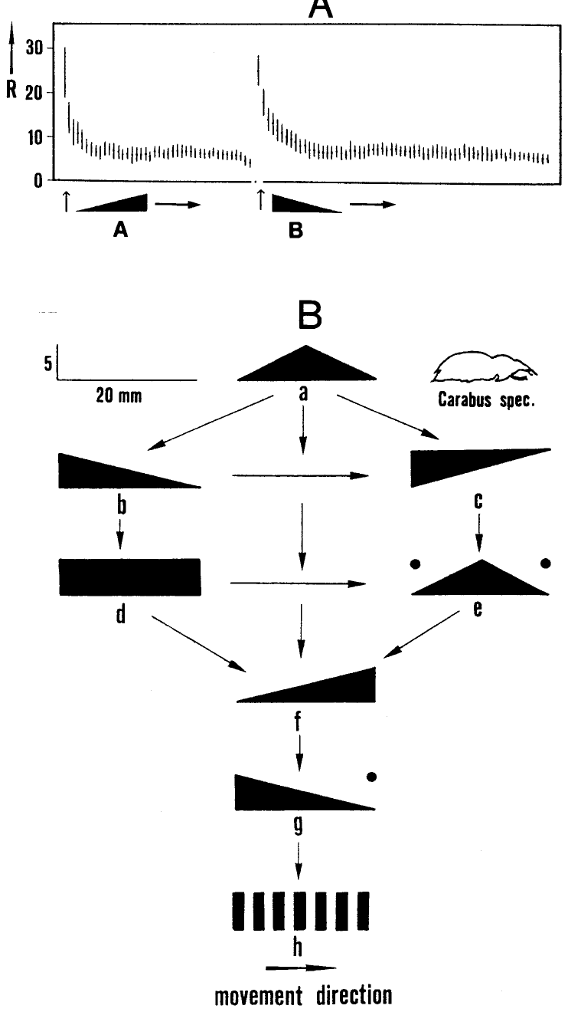
Habituation to prey dummies is stimulus-specific
Habituation is a decrease in response with repeated stimulation. When a prey dummy circles repeatedly, the toad's orienting gradually stops. Responding recovers if the stimulus is withheld, presented to another part of the visual field, or altered.
Ewert and Kehl habituated toads to a black triangle moving with its narrow side leading (A). Immediately afterward the mirror-image triangle (B) elicited full responding, and it too habituated. The response decrement is therefore specific to stimulus features, which places the change in sensory and modulatory structures rather than in the motor system.
Testing many pairs revealed a dishabituation hierarchy: one pattern dishabituates all those below it but not vice versa, even though before habituation all were about equally effective. The toad can thus discriminate configurational cues, such as leading versus trailing edges, beyond the worm–antiworm rule.
Ewert et al. (2001), Fig. 16. Stimulus-specific habituation to triangles A and B (A) and the dishabituation hierarchy of moving patterns (B); inset: beetle Carabus.
Ewert et al. (2001)
32
Notes:
• Habituation is a drop in responding to a repeated stimulus.
– A toad shown the same prey dummy over and over eventually stops turning toward it.
• The decline is specific to the stimulus.
– After habituating to one triangle, the toad responded fully to its mirror image.
– That means the change lies in recognition, not in fatigue of the motor system.
• Testing many pairs produced a hierarchy: some patterns renewed responding to others but not the reverse. So toads can tell apart features like leading and trailing edges that the basic worm rule does not capture.
References:
Ewert JP, Buxbaum-Conradi H, Dreisvogt F, Glagow M, Merkel-Harff C, Röttgen A, Schürg-Pfeiffer E, Schwippert WW (2001). Neural modulation of visuomotor functions underlying prey-catching behaviour in anurans: perception, attention, motor performance, learning. Comparative Biochemistry and Physiology A 128: 417–461. https://doi.org/10.1016/S1095-6433(00)00333-0
Figure: Ewert et al. (2001), Fig. 16. Stimulus-specific habituation to triangles A and B (A) and the dishabituation hierarchy of moving patterns (B); inset: beetle Carabus.
Figure source: https://doi.org/10.1016/S1095-6433(00)00333-0

Slide 42
Habituation spares the retina and the motor system
Two simpler processes can also make responses fade: motor fatigue, a decline in the muscles or pattern generators that execute the turn, and sensory adaptation, a decline in receptor or retinal responses to sustained stimulation. Either would weaken responses to any stimulus that uses the same pathway.
The mirror-image triangle has the same area, contrast and speed as the habituated one and moves along the same path, so it drives the same retinal size classes and calls on the same turning movement. Full responding to it rules out both fatigue and adaptation and leaves a change at a stage where leading and trailing edges are told apart.
Striatal neurons are one candidate site, since most of them habituated to repeated stimulation, and Ewert attributed stimulus-specific habituation to loops involving the ventral medial pallium. For the toad, an object that keeps passing without being caught stops drawing turns, while a differently shaped object in the same place still does.
Ewert et al. (2001), Fig. 16. Stimulus-specific habituation to triangles A and B (A) and the dishabituation hierarchy of moving patterns (B); inset: beetle Carabus.
Ewert et al. (2001)
32a
Notes:
• The mirror-image control on slide 32 is a compact piece of experimental logic that rules out two common alternatives to habituation.
• Three ways a response can fade.
– The motor system could tire, the sense organ or retina could adapt, or a central stage could learn that the stimulus is unimportant.
– Only the last is habituation in the strict sense, a form of non-associative learning.
• Why the mirror image is the right test.
– Mirror-image triangles share area, contrast and speed, which are the properties the retinal ganglion cell classes on slides 10 and 16 report.
– They also call on the same orienting turn, so a tired motor system would fail on both.
– Full recovery to the mirror image therefore means the decrement sits where configuration is coded.
• Where and why.
– Slide 25 notes that most striatal neurons habituate, and Ewert's 2001 review assigns stimulus-specific habituation to modulatory loops involving the ventral medial pallium.
– Behaviorally, the toad stops spending turns on an object that keeps passing uncaught while remaining fully responsive to anything new.
References:
Ewert JP, Buxbaum-Conradi H, Dreisvogt F, Glagow M, Merkel-Harff C, Röttgen A, Schürg-Pfeiffer E, Schwippert WW (2001). Neural modulation of visuomotor functions underlying prey-catching behaviour in anurans: perception, attention, motor performance, learning. Comparative Biochemistry and Physiology A 128: 417–461. https://doi.org/10.1016/S1095-6433(00)00333-0

Slide 43
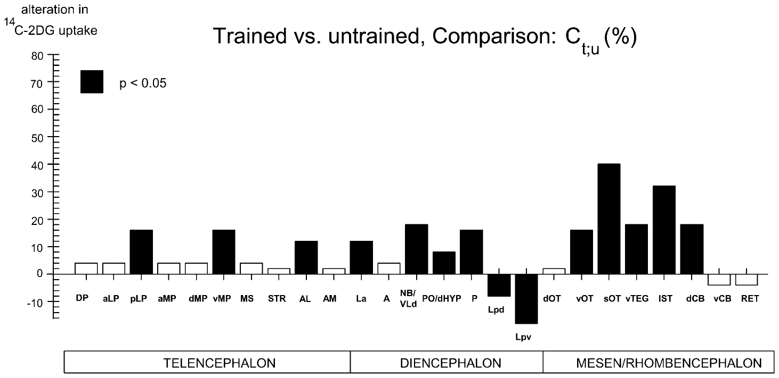
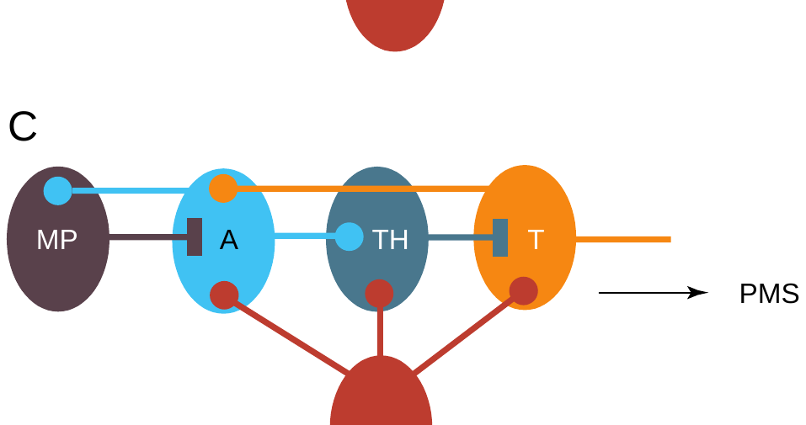
Hand-feeding teaches toads to treat a threat as prey
In the hand-feeding paradigm, a toad was allowed to catch a mealworm from the experimenter's hand once daily. The moving hand is a threatening stimulus, and naive toads hesitate. After about 7 weeks, toads oriented and snapped about eight times per minute toward the hand alone: the hand (conditioned stimulus) had been associated with prey (unconditioned stimulus).
The effect generalized: antiworm bars and large moving squares were included in the prey schema. Controls exposed to hand and mealworm without contingency kept normal selectivity. Trained toads thus behaved like pretectally lesioned toads.
In 2DG experiments with a large moving square, trained toads showed increased uptake in the ventral medial pallium (vMP) and tectal structures and decreased uptake in the pretectal Lpd and Lpv nuclei. Ewert proposed that the pallium inhibits pretecto-tectal inhibition via the anterior thalamus.
Ewert et al. (2001), Fig. 18. 2DG uptake in trained versus untrained toads viewing a large square; filled bars significant.
Ewert (1997), Fig. 1C. Proposed learning loop: medial pallium (MP) inhibits pretecto-tectal inhibition via anterior thalamus (A).
Ewert et al. (2001); Ewert (1997)
33
Notes:
• In the hand-feeding experiment, toads took a mealworm from the experimenter's hand once a day.
– A moving hand is normally a threat, but after about seven weeks the toads turned and snapped at the hand alone.
• The learning spread.
– Trained toads also treated antiworms and large squares as prey, much like toads without a pretectum, while controls given hand and mealworm separately stayed normal.
• Brain activity mapping showed more activity in the ventral medial pallium and less in the pretectum. Ewert proposed that the pallium, through the anterior thalamus, switches off the pretectal inhibition.
References:
Ewert JP, Buxbaum-Conradi H, Dreisvogt F, Glagow M, Merkel-Harff C, Röttgen A, Schürg-Pfeiffer E, Schwippert WW (2001). Neural modulation of visuomotor functions underlying prey-catching behaviour in anurans: perception, attention, motor performance, learning. Comparative Biochemistry and Physiology A 128: 417–461. https://doi.org/10.1016/S1095-6433(00)00333-0
Ewert JP (1997). Neural correlates of key stimulus and releasing mechanism: a case study and two concepts. Trends in Neurosciences 20(8): 332–339. https://doi.org/10.1016/S0166-2236(96)01042-9
Figure: Ewert et al. (2001), Fig. 18. 2DG uptake in trained versus untrained toads viewing a large square; filled bars significant.
Figure source: https://doi.org/10.1016/S1095-6433(00)00333-0
Figure: Ewert (1997), Fig. 1C. Proposed learning loop: medial pallium (MP) inhibits pretecto-tectal inhibition via anterior thalamus (A).
Figure source: https://doi.org/10.1016/S0166-2236(96)01042-9

Slide 44
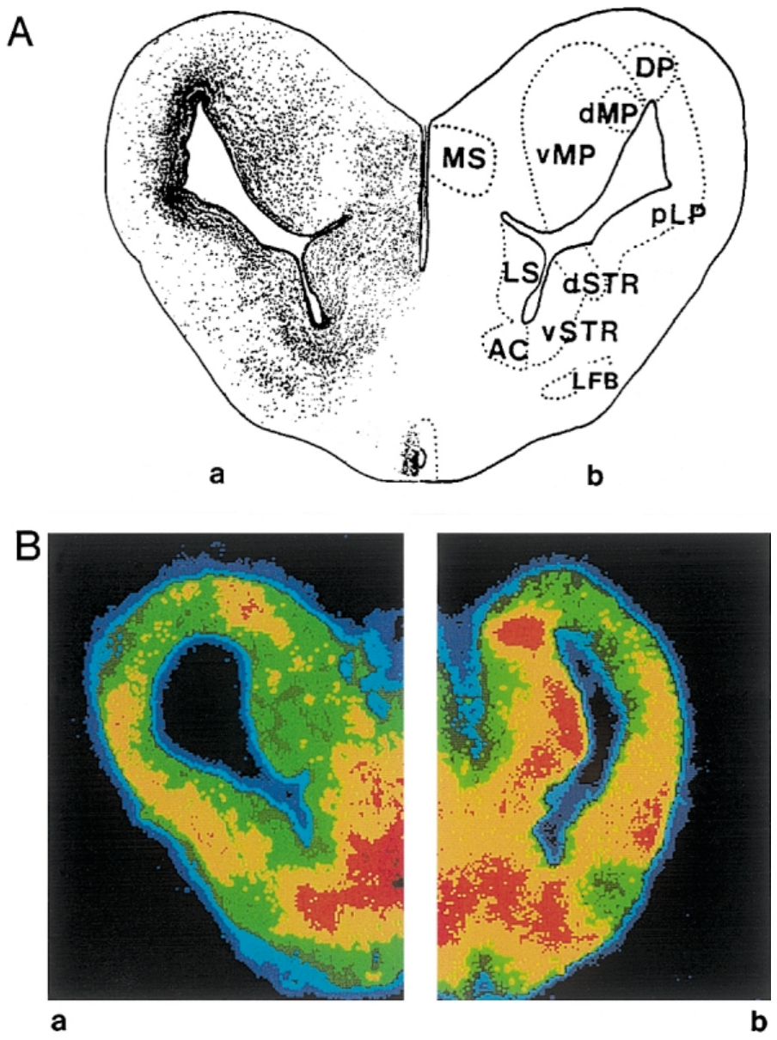
A prey-associated odor activates the hippocampal pallium
Merkel-Harff and Ewert paired the odor cineol with visual prey in repeated training sessions. In naive toads, cineol presented with prey reduced prey-catching; after training, the prey-associated odor facilitated prey-catching and reduced prey selectivity, and the odor alone elicited orienting movements in arbitrary directions.
2DG autoradiography located a key structure. In a binocularly enucleated (blinded) toad without odor stimulation, the caudal ventral medial pallium (vMP) showed no 2DG uptake. In a blinded toad stimulated with the prey-associated cineol, vMP uptake was strong.
The vMP, the amphibian homolog of the hippocampus, thus responds to a learned olfactory prey cue even without vision. Ewert et al. proposed that vMP output disinhibits tectal T5.1 and T5.2 neurons through hypothalamic pathways, raising conditioned prey-catching motivation.
Ewert et al. (2001), Fig. 22. Caudal telencephalon (A); 2DG uptake in vMP of a blinded toad without (Ba) and with (Bb) prey-associated cineol.
Ewert et al. (2001)
34
Notes:
• Here the cue was a smell.
– Toads learned that the odor cineol came with prey.
– Before training cineol reduced prey-catching, but afterward it increased prey-catching and made toads less choosy.
• Brain mapping showed where the learned odor acts.
– In blinded toads, the ventral medial pallium was silent without the odor and strongly active with the prey-associated odor.
• The ventral medial pallium is the amphibian hippocampus. Ewert proposed that it raises prey-catching motivation by releasing the tectal prey neurons from inhibition.
References:
Ewert JP, Buxbaum-Conradi H, Dreisvogt F, Glagow M, Merkel-Harff C, Röttgen A, Schürg-Pfeiffer E, Schwippert WW (2001). Neural modulation of visuomotor functions underlying prey-catching behaviour in anurans: perception, attention, motor performance, learning. Comparative Biochemistry and Physiology A 128: 417–461. https://doi.org/10.1016/S1095-6433(00)00333-0
Figure: Ewert et al. (2001), Fig. 22. Caudal telencephalon (A); 2DG uptake in vMP of a blinded toad without (Ba) and with (Bb) prey-associated cineol.
Figure source: https://doi.org/10.1016/S1095-6433(00)00333-0

Slide 45
Learning changes a cue's value, not its detection
Cineol switched sign through association. Before training it suppressed prey-catching, and after pairing with prey it facilitated it, although the odor itself was unchanged. What changed was the cue's learned value, assigned by structures linking the odor to its outcome.
Controls given the hand and the mealworm unpaired stayed as selective as untrained toads, which rules out familiarity with the hand. Blinding before the 2DG test meant that vMP activity during the odor arose without any sight of prey.
Learning and lesions reach the same target by different routes. A pretectal lesion removes the veto permanently, along with distance judgment; training lowered activity in pretectal Lpd and Lpv through pallial loops for a learned context. The pretecto-tectal veto is the element experience adjusts.
Ewert et al. (2001), Fig. 22. Caudal telencephalon (A); 2DG uptake in vMP of a blinded toad without (Ba) and with (Bb) prey-associated cineol.
Ewert et al. (2001); Ewert (1997)
34a
Notes:
• The learning experiments on slides 33 and 34 change what a stimulus means to the toad without changing how it is sensed, and the controls are built to exclude simpler explanations.
• Value versus detection.
– The same cineol odor first reduced prey-catching and later increased it.
– Nothing about the odor or the nose changed between those tests, so the change must lie in structures that store what the odor predicts.
• What the controls exclude.
– The non-contingent group on slide 33 saw the hand and received mealworms as often as trained toads, but not together, and kept normal selectivity.
– Binocular enucleation on slide 34 removes vision, so the strong ventral medial pallium signal reflects the learned odor and not any visual prey cue.
• Same target, different routes.
– After pretectal loss on slides 18 and 22, toads strike at everything and misjudge distance.
– Trained toads also accepted antiworms and large squares, but the 2DG data on slide 33 point to reduced pretectal activity driven by pallial loops, which Ewert's 1997 scheme routes through the anterior thalamus.
References:
Ewert JP, Buxbaum-Conradi H, Dreisvogt F, Glagow M, Merkel-Harff C, Röttgen A, Schürg-Pfeiffer E, Schwippert WW (2001). Neural modulation of visuomotor functions underlying prey-catching behaviour in anurans: perception, attention, motor performance, learning. Comparative Biochemistry and Physiology A 128: 417–461. https://doi.org/10.1016/S1095-6433(00)00333-0
Ewert JP (1997). Neural correlates of key stimulus and releasing mechanism: a case study and two concepts. Trends in Neurosciences 20(8): 332–339. https://doi.org/10.1016/S0166-2236(96)01042-9

Slide 46
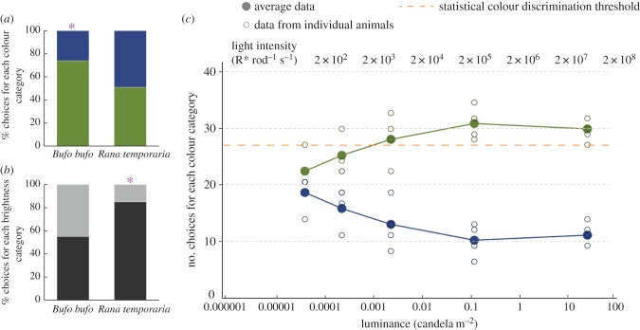
Toads use color when choosing prey
Yovanovich and colleagues tested whether toads (Bufo bufo) and frogs (Rana temporaria) use color in prey-catching. Moving prey dummies of different colors and brightness were presented at controlled light levels.
At 40 cd/m², toads chose green dummies over blue ones about three times out of four, a significant color preference, whereas frogs showed no significant color preference but strongly preferred darker stimuli.
As luminance decreased, the toads' green preference persisted down to dim light but disappeared at the lowest intensities, where vision depends on rods. The authors found no evidence of rod-based color discrimination in prey-catching or mate choice. By contrast, frogs jumping toward lit windows could discriminate blue from green down to the absolute visual threshold. Color processing therefore depends on the task.
Yovanovich et al. (2017), Fig. 2. Prey choices by color (a) and brightness (b) in Bufo and Rana at 40 cd/m²; toad color choices across luminance (c).
Yovanovich et al. (2017)
35
Notes:
• Ewert's dummies were black and white, but toads also see color.
– Yovanovich and colleagues offered toads and frogs colored moving dummies.
• In good light, toads chose green over blue about three times out of four.
– Frogs did not show a color preference in prey-catching but strongly preferred darker objects.
• The toads' preference faded in very dim light, where only rods work. Frogs jumping toward light could tell blue from green even at the visual threshold, so whether color is used depends on the behavior.
References:
Yovanovich CAM, Koskela SM, Nevala N, Kondrashev SL, Kelber A, Donner K (2017). The dual rod system of amphibians supports colour discrimination at the absolute visual threshold. Philosophical Transactions of the Royal Society B 372: 20160066. https://doi.org/10.1098/rstb.2016.0066
Figure: Yovanovich et al. (2017), Fig. 2. Prey choices by color (a) and brightness (b) in Bufo and Rana at 40 cd/m²; toad color choices across luminance (c).
Figure source: https://doi.org/10.1098/rstb.2016.0066

Slide 47
Color vision needs two receptor types compared
A single photoreceptor type confounds wavelength with intensity: each absorbed photon produces the same signal whatever its color. Color discrimination requires comparing two receptor types with different spectral sensitivities.
Amphibians have two rod types: green-sensitive rods peaking near 502 nm, the common vertebrate rod, and blue-sensitive rods peaking near 432 nm. Comparing them offers color vision when cones are silent, and the test stimuli were designed to excite the two rod types differently.
Both species carry the two rod types, so the toad and frog results point downstream. The authors proposed that the phototaxis pathway compares rod signals close to motor output, whereas prey-catching color choice is set by sensitive blue-sensitive cones. In very dim light, toads still hunt in achromatic mode.
Yovanovich et al. (2017), Fig. 2. Prey choices by color (a) and brightness (b) in Bufo and Rana at 40 cd/m²; toad color choices across luminance (c).
Yovanovich et al. (2017)
35a
Notes:
• Slide 35 reports that color use depends on the task, and the explanation starts with what any color vision system needs.
• The principle of univariance.
– A photoreceptor counts absorbed photons, and each absorbed photon has the same effect regardless of its wavelength.
– Wavelength only changes the probability that a photon is absorbed, so one receptor type cannot tell a dim green light from a brighter blue one; two types with different sensitivities can, by comparing their signals.
• The amphibian dual rod system.
– Yovanovich and colleagues list rod peaks of about 502 nanometers for the common rod type and about 432 nanometers for the blue-sensitive rods in Bufo bufo.
– Their blue and green stimuli were chosen to excite these two rod types quantifiably and differently.
• Why toads and frogs differ.
– The authors found the toads' color threshold in prey-catching consistent with blue-sensitive cones, which are very sensitive in amphibians.
– In phototaxis, frogs discriminated blue from green at threshold, which they explain by a comparison of the two rod signals in a pathway close to the motor output.
– Toads keep trying to catch prey in achromatic mode at very low light, so color is a dispensable cue for hunting.
References:
Yovanovich CAM, Koskela SM, Nevala N, Kondrashev SL, Kelber A, Donner K (2017). The dual rod system of amphibians supports colour discrimination at the absolute visual threshold. Philosophical Transactions of the Royal Society B 372: 20160066. https://doi.org/10.1098/rstb.2016.0066

Slide 48
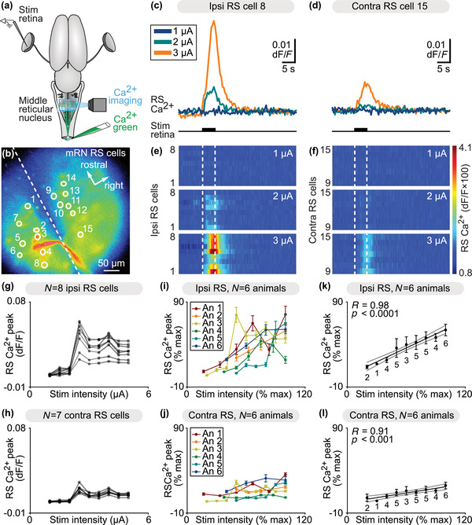
Retinal input reaches salamander reticulospinal neurons
Flaive and Ryczko used an isolated salamander brain with eyes attached. They stimulated the retina electrically and imaged calcium in reticulospinal (RS) neurons of the middle reticular nucleus, which control steering movements.
Retinal stimulation evoked calcium responses in RS neurons, and response size grew with stimulus intensity. Responses on the side ipsilateral to the stimulated retina were larger than contralateral ones, a bias suited to turning toward one side.
Microinjection of glutamate receptor antagonists into the optic tectum reduced the RS responses, and tracing showed tectal projections onto RS neurons, which in turn contact spinal motoneurons. This establishes a cellular substrate, retina → tectum → reticulospinal neurons → motoneurons, for the visually guided orientation that Ewert studied behaviorally in toads.
Flaive & Ryczko (2022), Fig. 7. Retinal stimulation evokes graded calcium responses in ipsilateral and contralateral reticulospinal neurons of the middle reticular nucleus.
Flaive & Ryczko (2022)
36
Notes:
• Flaive and Ryczko kept a salamander brain alive with the eyes attached.
– They stimulated the retina and watched calcium signals in reticulospinal neurons that control steering.
• The neurons responded more as the stimulus got stronger, and more on one side than the other, which is what a turning command needs.
– The colors in the heat maps show the size of the calcium response.
• Blocking glutamate receptors in the tectum reduced the responses, and tracing showed the connections. That gives a cell-by-cell route from eye to motoneurons for orienting toward prey.
References:
Flaive A, Ryczko D (2022). From retina to motoneurons: a substrate for visuomotor transformation in salamanders. Journal of Comparative Neurology 530(14): 2518–2536. https://doi.org/10.1002/cne.25348
Figure: Flaive & Ryczko (2022), Fig. 7. Retinal stimulation evokes graded calcium responses in ipsilateral and contralateral reticulospinal neurons of the middle reticular nucleus.
Figure source: https://doi.org/10.1002/cne.25348

Slide 49
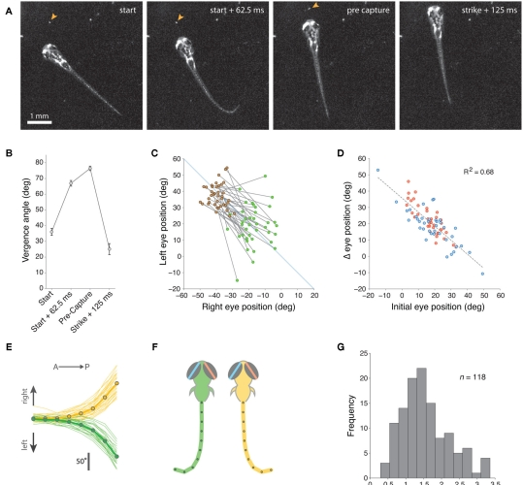
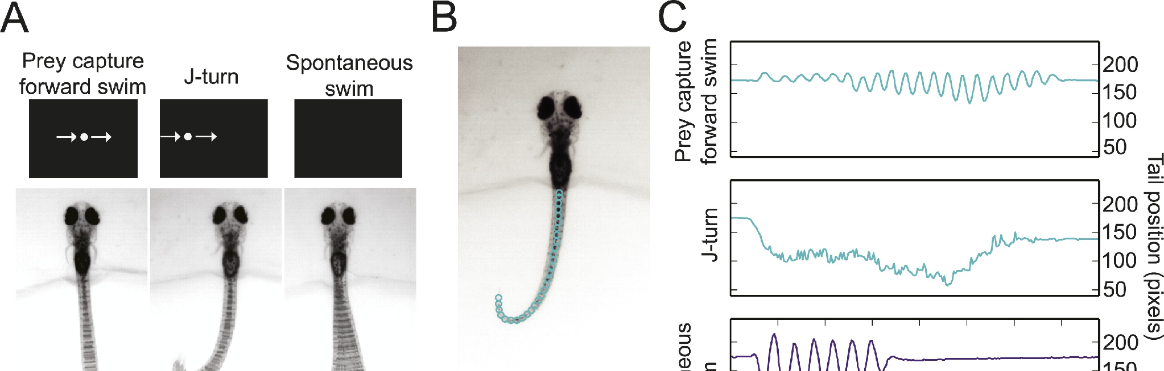
Zebrafish larvae converge their eyes to hunt prey
Larval zebrafish begin hunting paramecia at about 5 days after fertilization, and the accessibility of their brains makes them a modern model for the circuits Ewert studied.
Bianco, Kampff and Engert found that every prey-capture routine begins with eye convergence: both eyes rotate nasally, and vergence stays high during tracking and the capture swim before relaxing after the strike. Convergence enlarges the region of binocular overlap in front of the fish, which the authors proposed allows stereoscopic targeting of prey.
In a virtual-reality assay, small moving spots (about 1°) evoked low-amplitude orienting turns toward the spot, whereas larger spots (10°) evoked high-amplitude turns away. As in toads, the response category depends on stimulus size. Semmelhack and colleagues distinguished the hunting J-turn, a bend that holds the tail in a J shape, from spontaneous swims.
Bianco et al. (2011), Fig. 2. A larva hunting a paramecium (arrowhead), eye vergence at each stage (B–D), J-turn tail shapes (E–F) and prey distance at strike (G).
Semmelhack et al. (2014), Fig. 1A–C. Prey-capture forward swim, J-turn and spontaneous swim to virtual stimuli, with tail-position traces.
Bianco et al. (2011); Semmelhack et al. (2014)
37
Notes:
• Zebrafish larvae hunt small paramecia from about five days old, and their transparent brains let us image the circuits.
– Every hunt starts with both eyes turning inward, called eye convergence.
• The eyes stay converged during tracking and capture.
– That increases the area seen by both eyes, which the authors suggest helps judge distance to the prey.
• Small moving spots drew small turns toward them, while large spots drew big turns away. Just like the toad, size decides between prey and threat.
References:
Bianco IH, Kampff AR, Engert F (2011). Prey capture behavior evoked by simple visual stimuli in larval zebrafish. Frontiers in Systems Neuroscience 5: 101. https://doi.org/10.3389/fnsys.2011.00101
Semmelhack JL, Donovan JC, Thiele TR, Kuehn E, Laurell E, Baier H (2014). A dedicated visual pathway for prey detection in larval zebrafish. eLife 3: e04878. https://doi.org/10.7554/eLife.04878
Figure: Bianco et al. (2011), Fig. 2. A larva hunting a paramecium (arrowhead), eye vergence at each stage (B–D), J-turn tail shapes (E–F) and prey distance at strike (G).
Figure source: https://doi.org/10.3389/fnsys.2011.00101
Figure: Semmelhack et al. (2014), Fig. 1A–C. Prey-capture forward swim, J-turn and spontaneous swim to virtual stimuli, with tail-position traces.
Figure source: https://doi.org/10.7554/eLife.04878

Slide 50
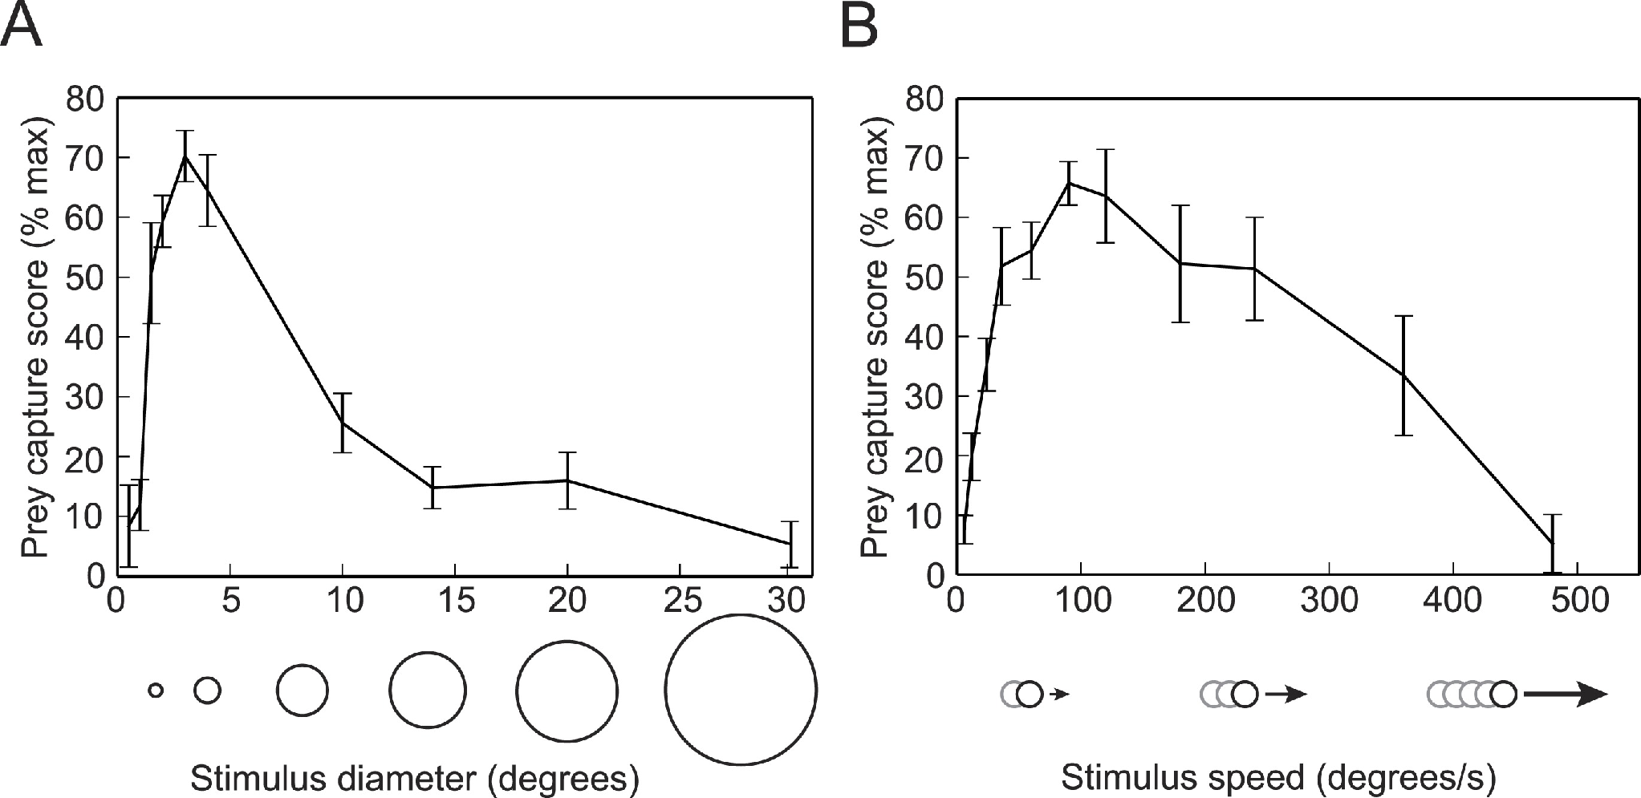
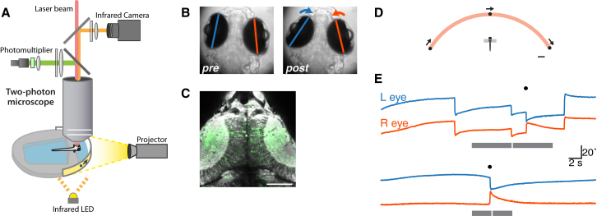
Small moving dots release zebrafish prey capture
Semmelhack and colleagues presented virtual prey to semi-restrained larvae whose tails were free to move. They distinguished prey-capture J-turns, in which the tail is held in a J shape to turn toward prey, and forward swims from spontaneous swims, using a machine-learning classifier of tail kinematics.
A prey-capture score was tuned to stimulus size and speed: it peaked for dots of about 3° moving at about 90–100°/s, and fell sharply for dots of 10° or more.
Bianco and Engert combined such a virtual hunting assay with two-photon calcium imaging of the tectum. Hunting responses depended on combinations of features: size, speed and contrast polarity. The tuning parallels the toad's preference for small, elongated objects moving along their axis.
Semmelhack et al. (2014), Fig. 2. Prey-capture score versus dot diameter (A) and speed (B) in semi-restrained larvae.
Bianco & Engert (2015), Fig. 1. Two-photon imaging during virtual hunting: setup, eye positions before and after convergence, and tectal imaging field.
Semmelhack et al. (2014); Bianco & Engert (2015)
38
Notes:
• Semmelhack and colleagues showed virtual dots to larvae held in agarose with the tail free.
– A computer classifier separated hunting movements, like J-turns, from ordinary swimming.
• Hunting was tuned to the dot.
– It peaked for dots about 3 degrees across moving at about 90 to 100 degrees per second and dropped off for big dots.
• Bianco and Engert imaged the tectum during the same kind of task and found that hunting depends on combinations of size, speed and contrast, a modern version of Ewert's configurational rules.
References:
Semmelhack JL, Donovan JC, Thiele TR, Kuehn E, Laurell E, Baier H (2014). A dedicated visual pathway for prey detection in larval zebrafish. eLife 3: e04878. https://doi.org/10.7554/eLife.04878
Bianco IH, Engert F (2015). Visuomotor transformations underlying hunting behavior in zebrafish. Current Biology 25(7): 831–846. https://doi.org/10.1016/j.cub.2015.01.042
Figure: Semmelhack et al. (2014), Fig. 2. Prey-capture score versus dot diameter (A) and speed (B) in semi-restrained larvae.
Figure source: https://doi.org/10.7554/eLife.04878
Figure: Bianco & Engert (2015), Fig. 1. Two-photon imaging during virtual hunting: setup, eye positions before and after convergence, and tectal imaging field.
Figure source: https://doi.org/10.1016/j.cub.2015.01.042

Slide 51
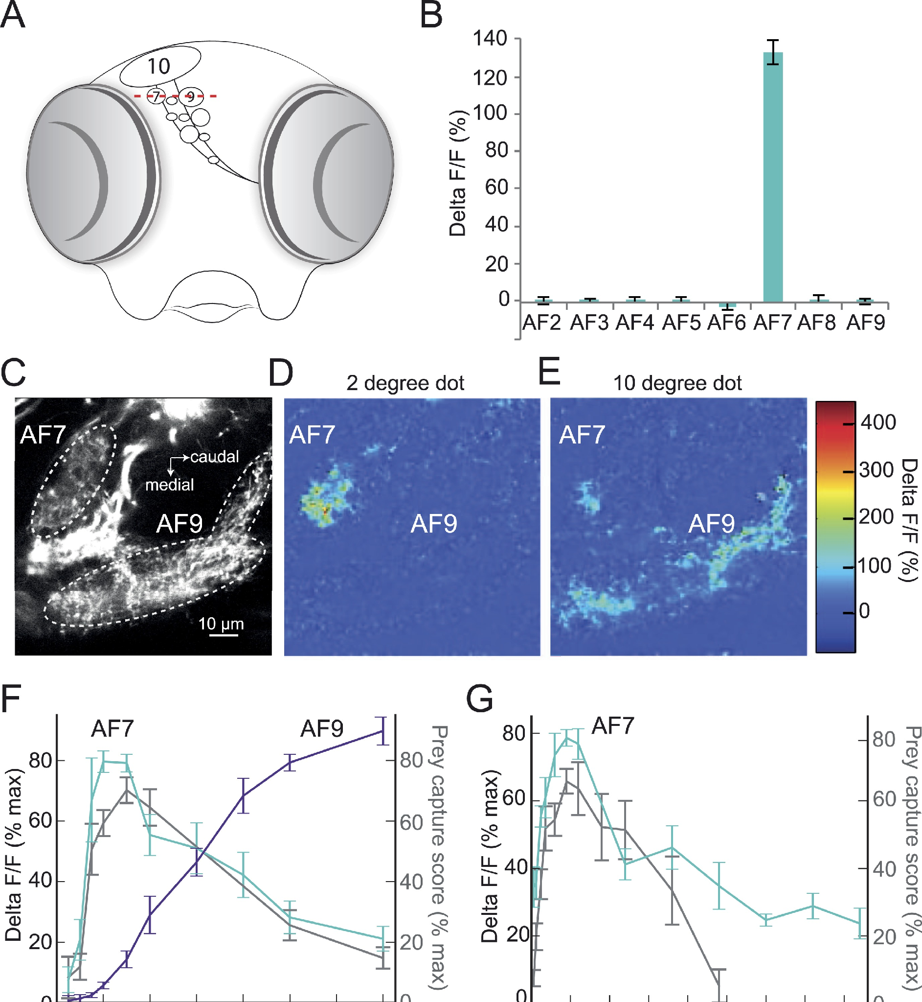
Pretectal area AF7 responds to prey-sized dots
Retinal ganglion cell axons in zebrafish end in ten arborization fields (AF1–AF10); AF10 is the tectum. Semmelhack and colleagues imaged calcium in retinal axons while presenting the optimal prey stimulus.
Only AF7, a small pretectal field, responded strongly to a 2° dot. AF9 responded to a 10° dot instead. AF7's size tuning matched the behavioral prey-capture curve, whereas AF9's increased with size, and both were tuned to speed.
AF7 is innervated by two types of retinal ganglion cells that also send collaterals to the tectum. A dedicated pretectal channel for prey-sized objects therefore exists in fish, at the same level of the visual system as the toad's pretectal region.
Semmelhack et al. (2014), Fig. 3A–G. Retinal arborization fields; AF7 responds to a 2° dot but AF9 to a 10° dot (color ΔF/F); size and speed tuning.
Semmelhack et al. (2014)
39
Notes:
• In zebrafish, retinal axons end in ten areas called arborization fields, and AF10 is the tectum.
– Imaging calcium in the retinal axons showed which areas respond to prey.
• Only AF7, in the pretectum, responded strongly to a small 2-degree dot.
– AF9 responded to larger dots instead, and AF7's size tuning matched the hunting behavior.
• So fish have a pretectal channel tuned to prey-sized objects, fed by retinal cells that also send branches to the tectum.
References:
Semmelhack JL, Donovan JC, Thiele TR, Kuehn E, Laurell E, Baier H (2014). A dedicated visual pathway for prey detection in larval zebrafish. eLife 3: e04878. https://doi.org/10.7554/eLife.04878
Figure: Semmelhack et al. (2014), Fig. 3A–G. Retinal arborization fields; AF7 responds to a 2° dot but AF9 to a 10° dot (color ΔF/F); size and speed tuning.
Figure source: https://doi.org/10.7554/eLife.04878

Slide 52
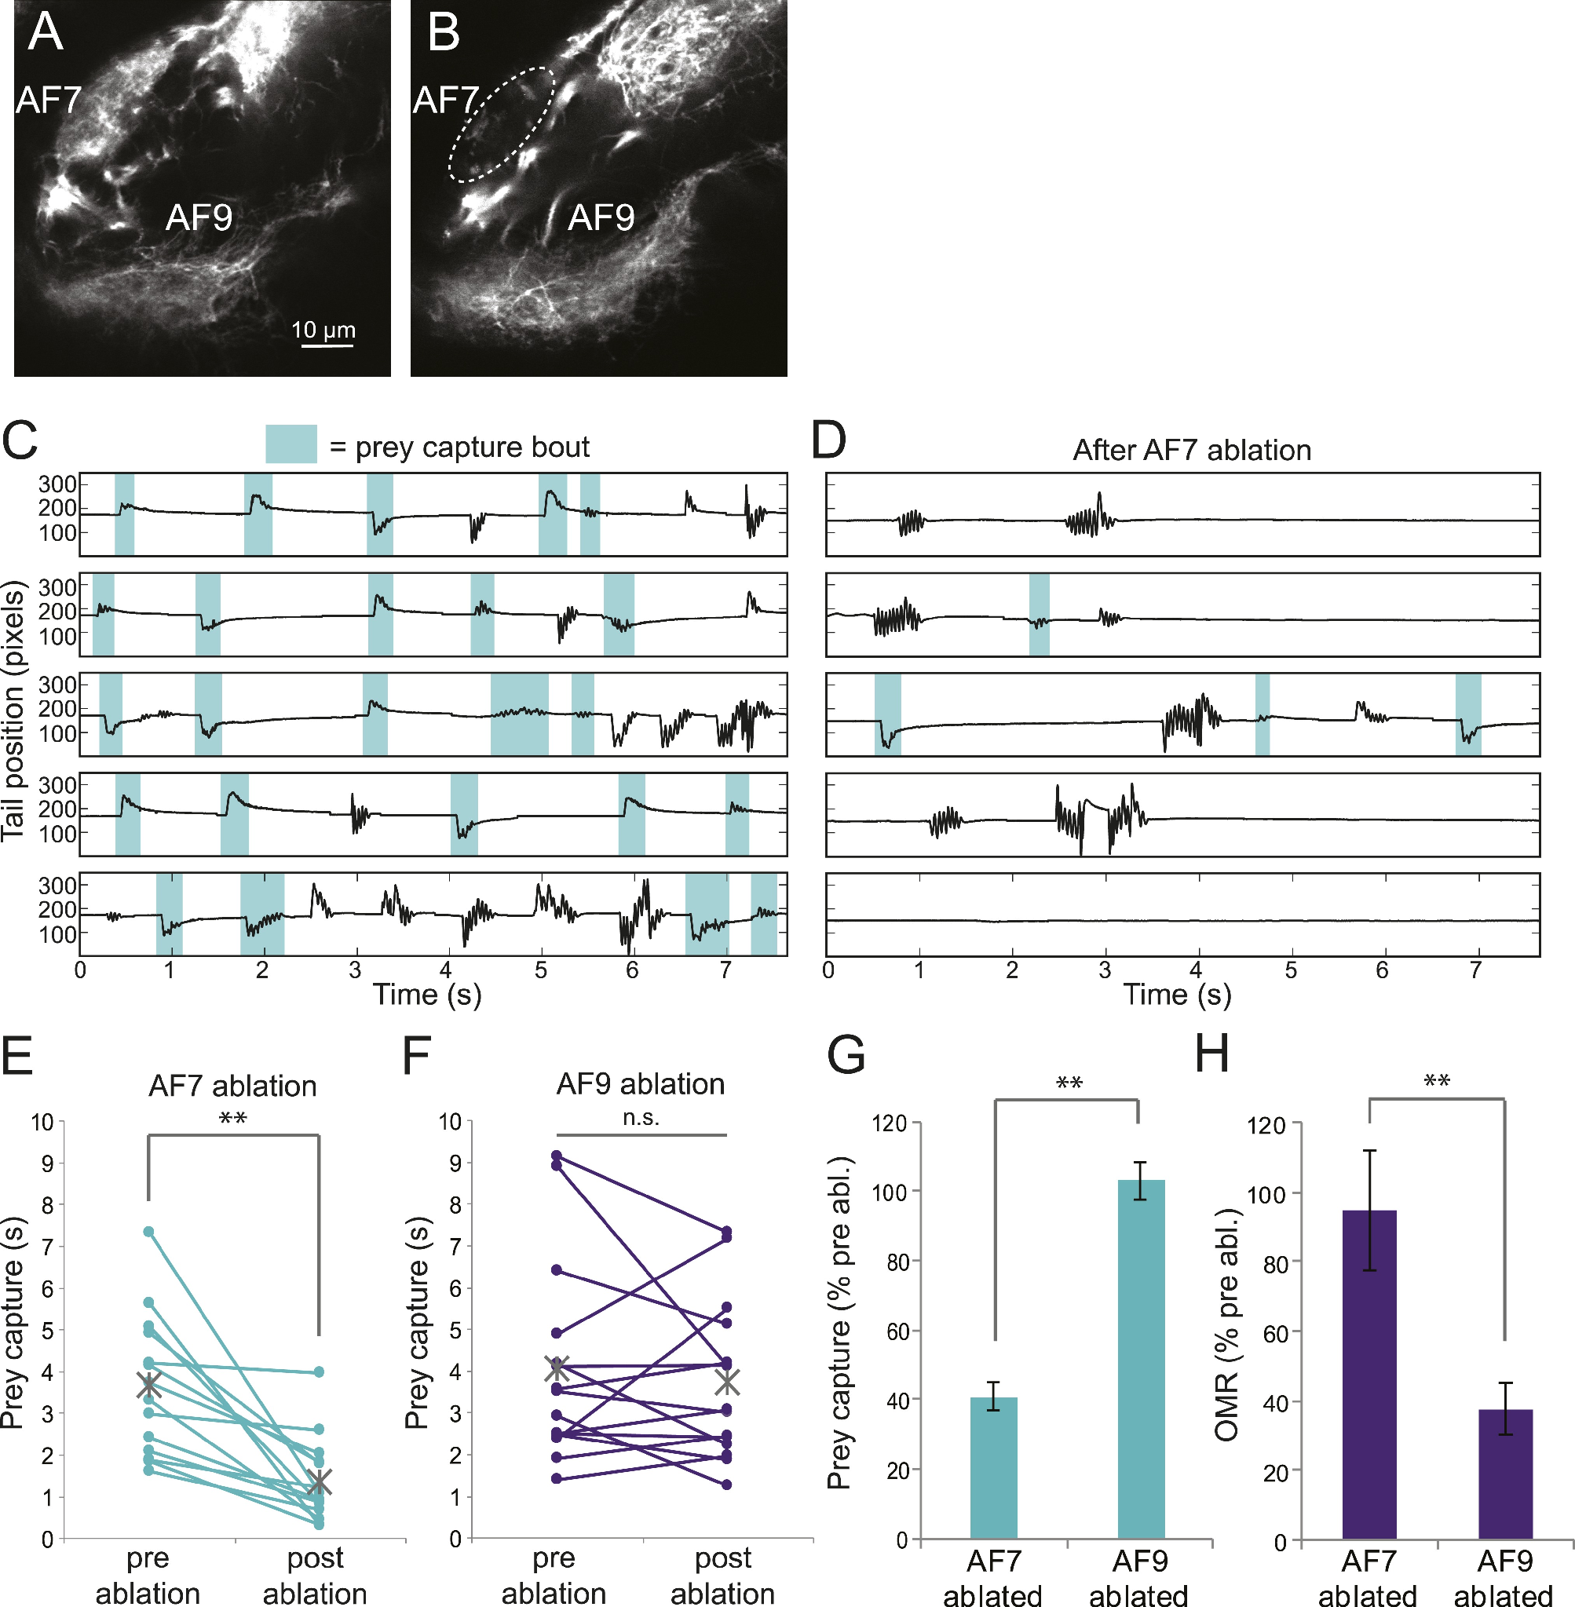
AF7 ablation impairs prey capture, not optomotor turning
To test whether AF7 is needed, Semmelhack and colleagues laser-ablated the retinal axons in AF7 or, as a control, in AF9.
After AF7 ablation, prey-capture bouts (shaded in the tail traces) were greatly reduced, and the time spent in prey capture fell to about 40% of pre-ablation levels. AF9 ablation left prey capture unchanged.
The optomotor response, swimming in the direction of moving gratings, was unaffected by AF7 ablation but reduced after AF9 ablation. AF7 is therefore selectively required for prey capture. Semmelhack and colleagues also found neurons with arbors in AF7 that projected to the tectum, the nucleus of the medial longitudinal fasciculus and the hindbrain.
Semmelhack et al. (2014), Fig. 6. AF7 before and after ablation (A–B); tail traces with prey-capture bouts (C–D); prey capture and optomotor response after AF7 or AF9 ablation (E–H).
Semmelhack et al. (2014)
40
Notes:
• Next, the AF7 axons were destroyed with a laser, and AF9 was destroyed in other fish as a control.
– Losing AF7 cut prey capture to about 40 percent, while losing AF9 had no effect on it.
• The optomotor response, swimming with moving stripes, showed the reverse.
– It was spared after AF7 ablation and reduced after AF9 ablation.
• So AF7 is specifically needed for hunting, and neurons reading out AF7 project to the tectum and to premotor areas.
References:
Semmelhack JL, Donovan JC, Thiele TR, Kuehn E, Laurell E, Baier H (2014). A dedicated visual pathway for prey detection in larval zebrafish. eLife 3: e04878. https://doi.org/10.7554/eLife.04878
Figure: Semmelhack et al. (2014), Fig. 6. AF7 before and after ablation (A–B); tail traces with prey-capture bouts (C–D); prey capture and optomotor response after AF7 or AF9 ablation (E–H).
Figure source: https://doi.org/10.7554/eLife.04878

Slide 53
Opposite deficits make the AF7 result specific
A lesion that lowers a behavior has dull explanations: general damage, poorer vision or a sick animal. A double dissociation, in which each of two lesions impairs a different behavior, excludes them: AF7 and AF9 ablations produced opposite deficits.
Neighboring retinal axons kept their course to the tectum and tectal neurons still responded to small stimuli, so lost hunting reflects lost AF7 terminals, not a disconnected tectum. The person scoring behavior did not know each larva's group.
Beside the toad, the sign of pretectal involvement reverses. A toad without its pretectum struck at more objects, whereas a larva without AF7 input hunted less, so this fish channel supplies drive. The remaining 40% fits other routes, such as tectal collaterals of AF7-projecting cells.
Semmelhack et al. (2014), Fig. 6. AF7 before and after ablation (A–B); tail traces with prey-capture bouts (C–D); prey capture and optomotor response after AF7 or AF9 ablation (E–H).
Semmelhack et al. (2014); Ewert et al. (2001)
40a
Notes:
• The AF7 ablation is persuasive because of its controls, and those controls are worth walking through before comparing the result with the toad.
• Double dissociation.
– A single lesion that reduces prey capture could simply have damaged the larva's vision or health.
– When a second lesion of similar size, in AF9, impairs a different visual behavior while sparing prey capture, a general explanation no longer fits either result.
• Checking the damage itself.
– Semmelhack and colleagues imaged the retinal axons passing near AF7 and found their projection to the tectum intact after ablation.
– They also recorded tectal neurons and found responses to small stimuli unchanged, and the experimenter scoring post-ablation behavior was blinded to group.
• Comparison with the toad.
– Removing the toad pretectum on slide 18 broadens prey-catching, while removing AF7 input on slide 40 narrows it.
– Slide 39 notes that AF7-projecting retinal cells also send collaterals to the tectum, and the authors suggest that incomplete ablation or other retinal inputs explain the residual hunting.
References:
Semmelhack JL, Donovan JC, Thiele TR, Kuehn E, Laurell E, Baier H (2014). A dedicated visual pathway for prey detection in larval zebrafish. eLife 3: e04878. https://doi.org/10.7554/eLife.04878
Ewert JP, Buxbaum-Conradi H, Dreisvogt F, Glagow M, Merkel-Harff C, Röttgen A, Schürg-Pfeiffer E, Schwippert WW (2001). Neural modulation of visuomotor functions underlying prey-catching behaviour in anurans: perception, attention, motor performance, learning. Comparative Biochemistry and Physiology A 128: 417–461. https://doi.org/10.1016/S1095-6433(00)00333-0

Slide 54
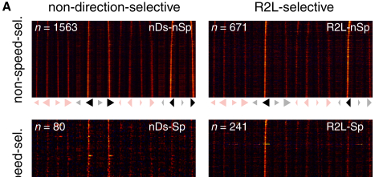
Tectal neurons combine features nonlinearly
Bianco and Engert imaged thousands of tectal neurons with GCaMP while larvae responded to moving spots that varied in size, speed, contrast polarity and direction.
They identified neurons tuned like the behavior: responsive to small, dark or bright, moving spots at hunting speeds, either regardless of direction or selective for left-to-right or right-to-left motion. These neurons showed nonlinear mixed selectivity: they responded strongly only to particular combinations of features, rather than summing feature preferences independently.
Comparing trials with and without a hunting response, they found small tectal assemblies whose activity preceded eye convergence. Bianco and Engert proposed that such neurons mediate prey recognition and that their premotor activity releases hunting. This parallels Ewert's T5.2 neurons, whose bursts predicted orienting.
Bianco & Engert (2015), Fig. 5A. Calcium responses of tectal neurons selected by behavioral tuning regressors, grouped by direction and speed selectivity.
Bianco & Engert (2015)
41
Notes:
• Bianco and Engert imaged thousands of tectal neurons at once while fish watched moving spots.
– Some neurons were tuned like the behavior, to small spots moving at hunting speeds, some in any direction and some in one direction only.
• These cells needed the right combination of features, not just one.
– That is called nonlinear mixed selectivity, and it is the kind of combining Ewert inferred for T5.2 neurons.
• Small groups of tectal neurons became active just before the fish converged its eyes, which suggests they help trigger the hunt, much like the T5.2 bursts before orienting in toads.
References:
Bianco IH, Engert F (2015). Visuomotor transformations underlying hunting behavior in zebrafish. Current Biology 25(7): 831–846. https://doi.org/10.1016/j.cub.2015.01.042
Figure: Bianco & Engert (2015), Fig. 5A. Calcium responses of tectal neurons selected by behavioral tuning regressors, grouped by direction and speed selectivity.
Figure source: https://doi.org/10.1016/j.cub.2015.01.042

Slide 55
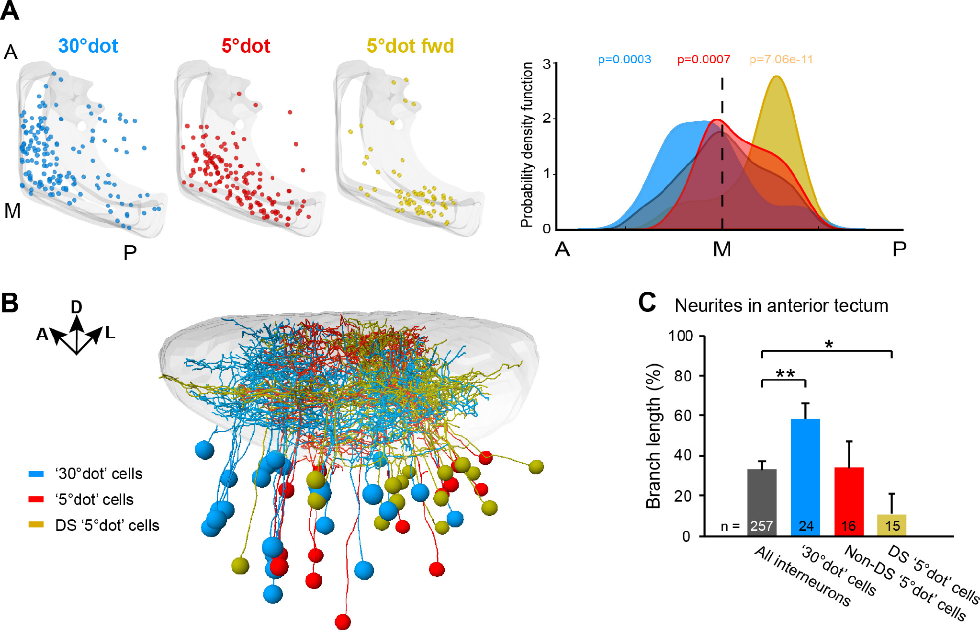
Anterior tectum is tuned to prey at close range
Prey is first seen in the peripheral visual field, which maps to the posterior tectum. As the larva turns and approaches, the prey image moves into the central binocular field, mapped to the anterior tectum, and appears larger.
Förster and colleagues imaged tectal neurons and found that cells responding to a small 5° dot, especially direction-selective ones, were concentrated in posterior and medial tectum. Cells tuned to a larger 30° dot were concentrated anteriorly, and anterior neurons were frequently not direction-selective.
The tectal map is therefore specialized by location for different stages of the hunt. Ablating tectal neurons tuned to large objects impaired hunting, indicating that the close-range representation is needed for capture.
Förster et al. (2020), Fig. 6. Positions of 30°-dot (blue), 5°-dot (red) and direction-selective 5°-dot (yellow) cells along the tectum; their neurite traces.
Förster et al. (2020)
42
Notes:
• Prey is first seen off to the side, which maps onto the back of the tectum, and as the fish approaches, the prey moves to the front of the visual field and looks bigger.
– Förster and colleagues asked whether the tectum is organized for this.
• Cells for small dots, especially direction-selective ones, sat in the posterior tectum, while cells for larger dots sat in the anterior tectum and were often not direction-selective.
• Killing the large-object cells impaired hunting, so the tectal map is laid out for distant prey in one place and close prey in another.
References:
Förster D, Helmbrecht TO, Mearns DS, Jordan L, Mokayes N, Baier H (2020). Retinotectal circuitry of larval zebrafish is adapted to detection and pursuit of prey. eLife 9: e58596. https://doi.org/10.7554/eLife.58596
Figure: Förster et al. (2020), Fig. 6. Positions of 30°-dot (blue), 5°-dot (red) and direction-selective 5°-dot (yellow) cells along the tectum; their neurite traces.
Figure source: https://doi.org/10.7554/eLife.58596

Slide 56
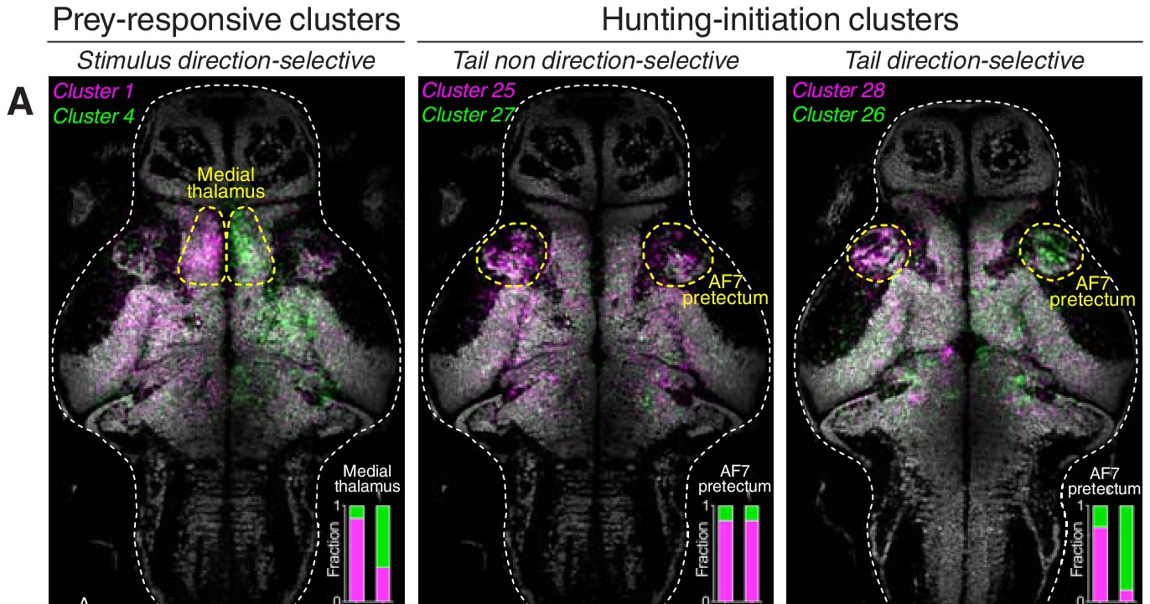
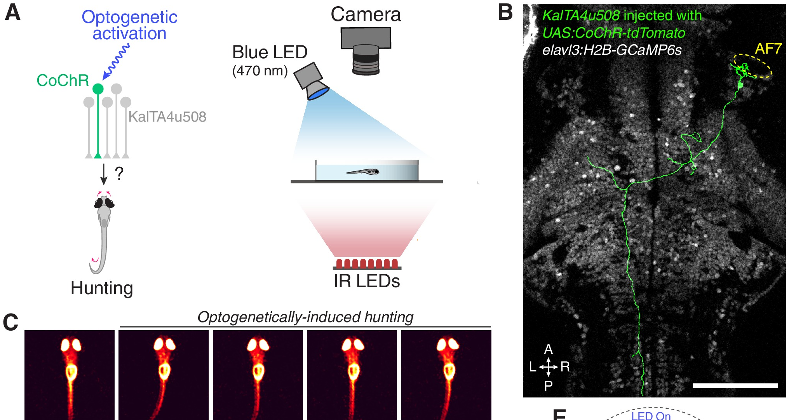
Single pretectal neurons can command hunting
Antinucci, Folgueira and Bianco imaged neurons across the larval brain during virtual hunting. A discrete region near AF7, the AF7-pretectum, contained a high density of neurons active specifically when larvae initiated hunting.
Using the KalTA4u508 line, they labeled two classes of these pretectal neurons, projecting to the ipsilateral tectum or to the contralateral tegmentum. Optogenetic stimulation of a single neuron of either class, using the light-gated channel CoChR, induced sustained hunting sequences, with eye convergence and J-turns, in the absence of prey.
Laser ablation of these neurons impaired prey-catching and prevented hunting evoked by stimulating the anterior-ventral tectum. The authors proposed that they form a command system for predatory behavior, a pretectal role unlike the inhibitory one Ewert described for non-prey.
Antinucci et al. (2019), Fig. 2A–B. Brain maps of prey-responsive and hunting-initiation neuron clusters; the AF7-pretectum is outlined.
Antinucci et al. (2019), Fig. 5A–C. Optogenetic stimulation of a single KalTA4u508 pretectal neuron (B) induces hunting with eye convergence (C).
Antinucci et al. (2019)
43
Notes:
• Antinucci and colleagues found a small pretectal region whose neurons became active when fish started to hunt.
– Two classes project to the tectum or to the tegmentum.
• Activating just one of these neurons with light was enough to start a full hunting sequence, eye convergence and J-turns, with no prey present.
– Removing them reduced prey-catching and blocked hunting triggered from the tectum.
• These pretectal cells work like a command system for hunting. In toads, the pretectum mainly vetoes non-prey; in fish, part of it starts the hunt.
References:
Antinucci P, Folgueira M, Bianco IH (2019). Pretectal neurons control hunting behaviour. eLife 8: e48114. https://doi.org/10.7554/eLife.48114
Figure: Antinucci et al. (2019), Fig. 2A–B. Brain maps of prey-responsive and hunting-initiation neuron clusters; the AF7-pretectum is outlined.
Figure source: https://doi.org/10.7554/eLife.48114
Figure: Antinucci et al. (2019), Fig. 5A–C. Optogenetic stimulation of a single KalTA4u508 pretectal neuron (B) induces hunting with eye convergence (C).
Figure source: https://doi.org/10.7554/eLife.48114

Slide 57
Sufficiency and necessity test a command system
A command neuron was defined as a cell both necessary and sufficient to initiate a behavior. Activation with no natural stimulus tests sufficiency; removal tests necessity. Activity that merely precedes a behavior, like a T5.2 burst before orienting, meets neither test.
One stimulated pretectal neuron evoked hunting in only about 20% of trials and after about 4 s, whereas stimulating the labeled population evoked it reliably within about 80 ms. Many cells acting together normally bring downstream pattern generators to threshold.
The authors therefore used the looser term command system, which drops the requirement that each cell be necessary. For the larva, hunting onset depends on prey evidence shared across many cells, yet a few surviving cells could still start hunts.
Antinucci et al. (2019), Fig. 2A–B. Brain maps of prey-responsive and hunting-initiation neuron clusters; the AF7-pretectum is outlined.
Antinucci et al. (2019), Fig. 5A–C. Optogenetic stimulation of a single KalTA4u508 pretectal neuron (B) induces hunting with eye convergence (C).
Antinucci et al. (2019); Ewert (1997); Bianco & Engert (2015)
43a
Notes:
• The pretectal hunting cells on slide 43 are described as a command system, and the term has a precise meaning that the experiments were designed to test.
• Two tests, two manipulations.
– Antinucci and colleagues quote the classic definition of a command neuron as both necessary and sufficient for initiating a behavior.
– Optogenetic activation in the absence of prey tests sufficiency, and ablation tests necessity.
– The T5.2 bursts on slide 17 and the tectal assemblies on slide 41 lead their behaviors in time, but timing alone tests neither property.
• What single-cell stimulation revealed.
– Stimulating one neuron produced hunting with low probability, around one trial in five, and with a long latency of about four seconds.
– Stimulating the whole labeled population produced hunting reliably and at short latency, about 80 milliseconds, comparable to natural hunting.
• Command system rather than command neuron.
– The authors adopt the looser definition used for interneurons whose activity accompanies and can induce a behavior, without requiring each cell to be necessary.
– Since one cell can release hunting, a few surviving cells could in principle suffice, which bears on why ablations reduce rather than abolish hunting.
References:
Antinucci P, Folgueira M, Bianco IH (2019). Pretectal neurons control hunting behaviour. eLife 8: e48114. https://doi.org/10.7554/eLife.48114
Ewert JP (1997). Neural correlates of key stimulus and releasing mechanism: a case study and two concepts. Trends in Neurosciences 20(8): 332–339. https://doi.org/10.1016/S0166-2236(96)01042-9
Bianco IH, Engert F (2015). Visuomotor transformations underlying hunting behavior in zebrafish. Current Biology 25(7): 831–846. https://doi.org/10.1016/j.cub.2015.01.042

Slide 58
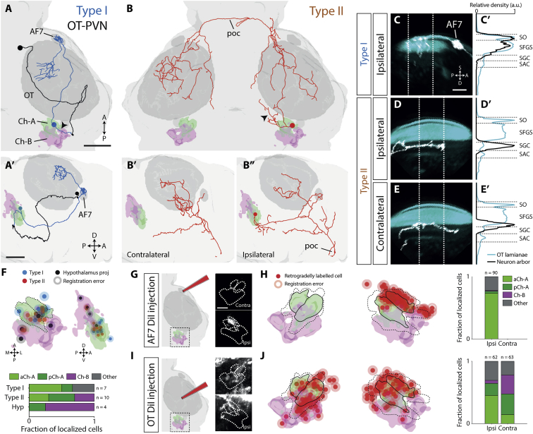
The nucleus isthmi sustains pursuit after hunting starts
The nucleus isthmi (NI) is a cholinergic nucleus reciprocally connected with the tectum; in amphibians its homolog has long been implicated in tectal function. Henriques and colleagues traced two types of NI projection neuron in zebrafish: type I projects ipsilaterally to retinorecipient laminae of tectum and pretectum, including AF7, and type II projects to both tectal hemispheres.
After laser ablation of NI, larvae detected prey and initiated hunting as often as controls, but they failed to sustain prey-tracking sequences: the abort rate rose from 0.60 to 0.80 and the capture rate fell from 0.36 to 0.16. Ablated larvae consumed fewer paramecia.
NI neurons became more active after hunting began. The authors proposed that NI provides state-dependent feedback facilitation to tectum and pretectum during pursuit.
Henriques et al. (2019), Fig. 2. Traced type I and type II nucleus isthmi projection neurons and their targets in tectum and pretectum (AF7).
Henriques et al. (2019)
44
Notes:
• The nucleus isthmi is a cholinergic nucleus wired in loops with the tectum.
– One type of isthmic neuron projects to the tectum and pretectum on the same side, and another to both tectal halves.
• Without the nucleus isthmi, fish still noticed prey and started hunting.
– But they gave up more often: aborted hunts went from 60 to 80 percent and captures from 36 to 16 percent.
• So this nucleus helps keep the pursuit going once it has started, by boosting tectal and pretectal activity during the hunt.
References:
Henriques PM, Rahman N, Jackson SE, Bianco IH (2019). Nucleus isthmi is required to sustain target pursuit during visually guided prey-catching. Current Biology 29(11): 1771–1786.e5. https://doi.org/10.1016/j.cub.2019.04.064
Figure: Henriques et al. (2019), Fig. 2. Traced type I and type II nucleus isthmi projection neurons and their targets in tectum and pretectum (AF7).
Figure source: https://doi.org/10.1016/j.cub.2019.04.064

Slide 59

Pretectal prey detectors drive a hypothalamic feeding center
Muto and colleagues imaged calcium in freely swimming larvae. The inferior lobe of the hypothalamus (ILH), a feeding center, became active when a larva converged its eyes on prey and rose further after capture.
Pretectal neurons were activated by paramecia: their activity rose as a larva approached prey, and in restrained larvae they responded best to virtual spots about 2–5° in size moving at intermediate speeds, matching the sizes and speeds of captured prey.
Single labeled pretectal neurons sent axons to the ILH, and pretectal and ILH activity were correlated. Ablation of the pretectum completely abolished prey capture, and silencing ILH neurons reduced feeding. The authors proposed that this pretecto-hypothalamic pathway converts visual prey detection into feeding motivation, linking recognition to the motivational state that, in toads, gates T5.2 responses.
Muto et al. (2017), Fig. 2a–h. Pretectal (PT) calcium responses to paramecia during hunting; tuning to spot diameter (g) and speed (h).
Muto et al. (2017)
45
Notes:
• Muto and colleagues watched the hypothalamic feeding center, the inferior lobe, in swimming larvae.
– It switched on when the larva converged its eyes on prey and rose further after the catch.
• Pretectal neurons responded to paramecia and to virtual spots of prey size and speed.
– Single pretectal neurons sent axons to the feeding center, and their activity was correlated with it.
• Removing the pretectum abolished prey capture. The authors proposed that this pathway turns seeing prey into the motivation to feed, the same kind of motivational state that in toads controls how strongly T5.2 neurons respond.
References:
Muto A, Lal P, Ailani D, Abe G, Itoh M, Kawakami K (2017). Activation of the hypothalamic feeding centre upon visual prey detection. Nature Communications 8: 15029. https://doi.org/10.1038/ncomms15029
Figure: Muto et al. (2017), Fig. 2a–h. Pretectal (PT) calcium responses to paramecia during hunting; tuning to spot diameter (g) and speed (h).
Figure source: https://doi.org/10.1038/ncomms15029

Slide 60
Key takeaways
Prey is defined by configuration. Toads prefer objects elongated along their direction of movement (worms) and reject the same objects moving across it (antiworms); the rule is invariant to direction, contrast and, within limits, speed.
No single cell is a worm detector. Retinal ganglion cells (R2–R4) encode size and contrast; tectal T5(2) neurons are selective in the same way as behavior, but no neuron is specific to one configuration.
Pretectal inhibition sharpens tectal selectivity. Pretectal TH3 neurons prefer large and antiworm stimuli; pretectal lesions or NPY block make T5.2 neurons and behavior respond to non-prey.
Forebrain loops gate and modify recognition. The striatum disinhibits the tectum via the pretectum to release prey-catching; the ventral medial pallium (hippocampus) alters prey selectivity after learning; dopamine shifts hunting to waiting.
Behavior emerges from sensorimotor codes. Combinations of tectal and pretectal streams, filtered by motivation, select turning, snapping or avoidance in medullary motor circuits.
Fish reveal the same logic at cellular level. Zebrafish prey detection uses a pretectal AF7 channel, tectal neurons with nonlinear mixed selectivity and pretectal command neurons that can start hunting.
Ewert et al. (1978); Ewert (1997); Ewert et al. (2001); Semmelhack et al. (2014)
46
Notes:
Ewert JP, Borchers HW, von Wietersheim A (1978). Question of prey feature detectors in the toad's Bufo bufo (L.) visual system: a correlation analysis. Journal of Comparative Physiology 126: 43–47. https://doi.org/10.1007/BF01342649
Ewert JP, Arend B, Becker V, Borchers HW (1979). Invariants in configurational prey selection by Bufo bufo (L.). Brain, Behavior and Evolution 16: 38–51. https://doi.org/10.1159/000121822
Schürg-Pfeiffer E, Ewert JP (1981). Investigation of neurons involved in the analysis of gestalt prey features in the frog Rana temporaria. Journal of Comparative Physiology 141: 139–152. https://doi.org/10.1007/BF01342660
Ewert JP (1997). Neural correlates of key stimulus and releasing mechanism: a case study and two concepts. Trends in Neurosciences 20(8): 332–339. https://doi.org/10.1016/S0166-2236(96)01042-9
Ewert JP, Buxbaum-Conradi H, Dreisvogt F, Glagow M, Merkel-Harff C, Röttgen A, Schürg-Pfeiffer E, Schwippert WW (2001). Neural modulation of visuomotor functions underlying prey-catching behaviour in anurans: perception, attention, motor performance, learning. Comparative Biochemistry and Physiology A 128: 417–461. https://doi.org/10.1016/S1095-6433(00)00333-0
Keeffe R, Blob R, Blackburn D, Mayerl C (2022). XROMM analysis of feeding mechanics in toads: interactions of the tongue, hyoid, and pectoral girdle. Integrative Organismal Biology 4(1): obac045. https://doi.org/10.1093/iob/obac045
Yovanovich CAM, Koskela SM, Nevala N, Kondrashev SL, Kelber A, Donner K (2017). The dual rod system of amphibians supports colour discrimination at the absolute visual threshold. Philosophical Transactions of the Royal Society B 372: 20160066. https://doi.org/10.1098/rstb.2016.0066
Flaive A, Ryczko D (2022). From retina to motoneurons: a substrate for visuomotor transformation in salamanders. Journal of Comparative Neurology 530(14): 2518–2536. https://doi.org/10.1002/cne.25348
Bianco IH, Kampff AR, Engert F (2011). Prey capture behavior evoked by simple visual stimuli in larval zebrafish. Frontiers in Systems Neuroscience 5: 101. https://doi.org/10.3389/fnsys.2011.00101
Semmelhack JL, Donovan JC, Thiele TR, Kuehn E, Laurell E, Baier H (2014). A dedicated visual pathway for prey detection in larval zebrafish. eLife 3: e04878. https://doi.org/10.7554/eLife.04878
Bianco IH, Engert F (2015). Visuomotor transformations underlying hunting behavior in zebrafish. Current Biology 25(7): 831–846. https://doi.org/10.1016/j.cub.2015.01.042
Förster D, Helmbrecht TO, Mearns DS, Jordan L, Mokayes N, Baier H (2020). Retinotectal circuitry of larval zebrafish is adapted to detection and pursuit of prey. eLife 9: e58596. https://doi.org/10.7554/eLife.58596
Antinucci P, Folgueira M, Bianco IH (2019). Pretectal neurons control hunting behaviour. eLife 8: e48114. https://doi.org/10.7554/eLife.48114
Henriques PM, Rahman N, Jackson SE, Bianco IH (2019). Nucleus isthmi is required to sustain target pursuit during visually guided prey-catching. Current Biology 29(11): 1771–1786.e5. https://doi.org/10.1016/j.cub.2019.04.064
Muto A, Lal P, Ailani D, Abe G, Itoh M, Kawakami K (2017). Activation of the hypothalamic feeding centre upon visual prey detection. Nature Communications 8: 15029. https://doi.org/10.1038/ncomms15029

