Slide 1
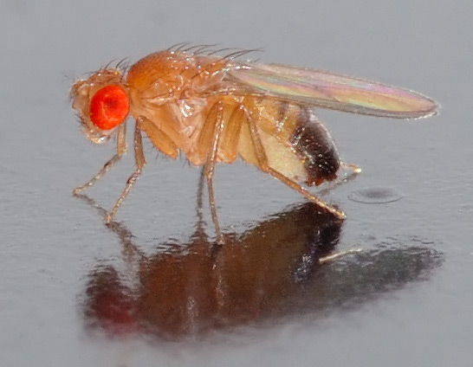
NEUR 411 · NEUROETHOLOGY · FALL 2026
Lecture 11
Insect vision I:
the fly optomotor response and the Reichardt elementary motion detector
Friday, September 18, 2026
Jordan Lopez, Ph.D.
Professor of Neurobiology & Biomedical Engineering
Photo: Drosophila melanogaster, the fruit fly used in the motion-vision experiments.
Notes:
Insect vision I: the fly optomotor response and the Reichardt elementary motion detector
Lecture 11. NEUR 411 · NEUROETHOLOGY · FALL 2026. Friday, September 18, 2026.
Image: Photo: Drosophila melanogaster, the fruit fly used in the motion-vision experiments. Credit: André Karwath. License: CC BY-SA 2.5. Source: https://commons.wikimedia.org/wiki/File:Drosophila_melanogaster_-_side_(aka).jpg

Slide 2
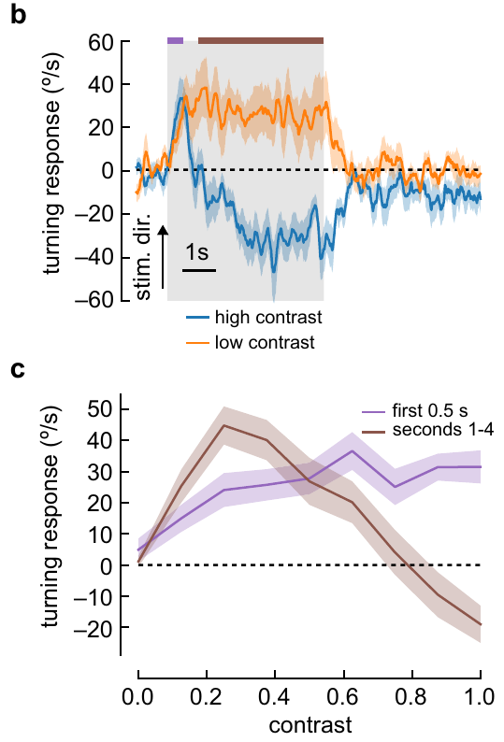
Flies turn with rotating visual patterns
The optomotor response is a turn in the direction of a rotating visual pattern. Such turns can reduce retinal slip, the movement of the environmental image across the eye during unintended body rotation. Turning direction therefore links visual motion to a measurable motor response.
Mano and colleagues measured tethered Drosophila melanogaster walking on an air-supported ball. A panoramic display covered 270°; ball rotation provided turning velocity in degrees per second while the fly remained at a fixed position.
At contrast 0.25, a sinusoidal grating with wavelength 60° moving at 1 Hz elicited sustained turning with the pattern. At contrast 1.0, turning changed direction after approximately 1 s. Optomotor behavior depends on stimulus conditions and elapsed time.
Mano et al. (2023), Fig. 1(b, c). Contrast changes turning during a 5-s rotating pattern.
Mano et al. (2023)
02
Notes:
• Retinal slip is visual image movement caused by motion between the animal and its surroundings. Turning with a drifting panorama can compensate for unintended body rotation, so the same visual stimulus can be related directly to a steering response.
• The fly walked on a ball rather than moving through the arena. Optical measurements of ball rotation supplied a turning velocity, while the experimenter controlled the visual panorama independently. This is an open-loop measurement because the animal's turns did not cancel the imposed pattern motion.
• The two contrast conditions differed in their long-term response even though their wavelength and temporal frequency matched. A response measured during the first half-second can therefore differ from one averaged across the entire five-second stimulus.
References:
Mano O, Choi M, Tanaka R, Creamer MS, Matos NCB, Shomar JW, Badwan BA, Clandinin TR, Clark DA (2023). Long-timescale anti-directional rotation in <i>Drosophila</i> optomotor behavior. eLife 12:e86076. https://doi.org/10.7554/elife.86076
Figure: Mano et al. (2023), Fig. 1(b, c). Contrast changes turning during a 5-s rotating pattern.
Figure source: https://doi.org/10.7554/elife.86076

Slide 3
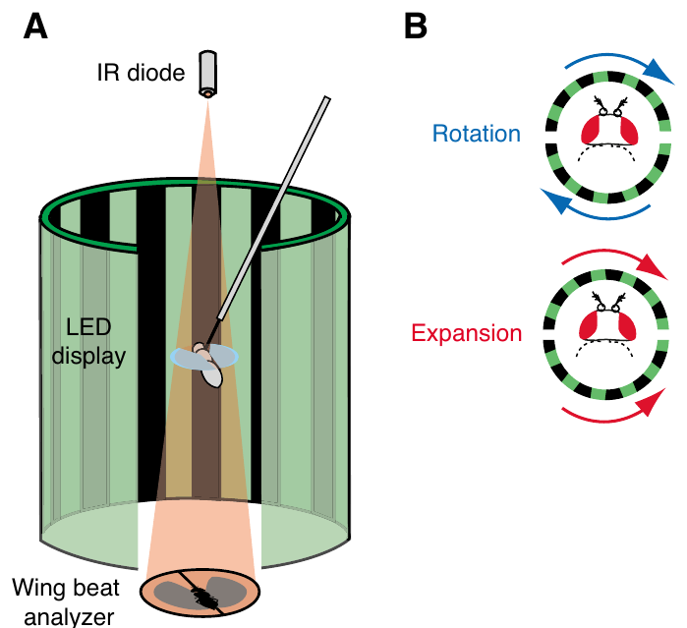
Controlled optic flow separates rotation from expansion
Optic flow is the pattern of image motion across the visual field. Duistermars and colleagues compared panoramic rotation with an expansion cue in tethered flying Drosophila. Rotation carried stripes in one direction around the fly; expansion reversed motion in the rear hemisphere.
Infrared light cast wing shadows onto sensors. The difference between left and right wingbeat amplitudes, ΔWBA, provided a steering measure proportional to yaw torque, the rotational force about the vertical body axis. The recorded voltage was a calibrated proxy for steering, not a body angle.
Each 3-s test followed closed-loop control of a vertical stripe. The expansion stimulus was an approximation to translation, with an abrupt velocity reversal between hemispheres, rather than the smooth flow field of natural forward flight.
Duistermars et al. (2007), Fig. 1. Tethered-flight apparatus and two panoramic flow fields.
Duistermars et al. (2007)
03
Notes:
• Rotation and translation produce different distributions of motion over the eye. The experiment changed the rear half of the panorama while keeping the front motion comparable, allowing the two flow arrangements to be tested with the same recording apparatus.
• A tethered fly can change its wing movements even though it cannot physically yaw. Comparing the two wing amplitudes gives a motor readout of attempted steering. The voltage axis reports the analyzer's output rather than degrees of actual rotation.
• Closed-loop stripe fixation kept the flies engaged before each open-loop test. Because the expansion cue used a square-wave velocity profile across azimuth, the result applies directly to this controlled approximation and should not be equated with every possible translational flow field.
References:
Duistermars BJ, Chow DM, Condro M, Frye MA (2007). The spatial, temporal and contrast properties of expansion and rotation flight optomotor responses in Drosophila. Journal of Experimental Biology 210:3218-3227. https://doi.org/10.1242/jeb.007807
Figure: Duistermars et al. (2007), Fig. 1. Tethered-flight apparatus and two panoramic flow fields.
Figure source: https://doi.org/10.1242/jeb.007807

Slide 4
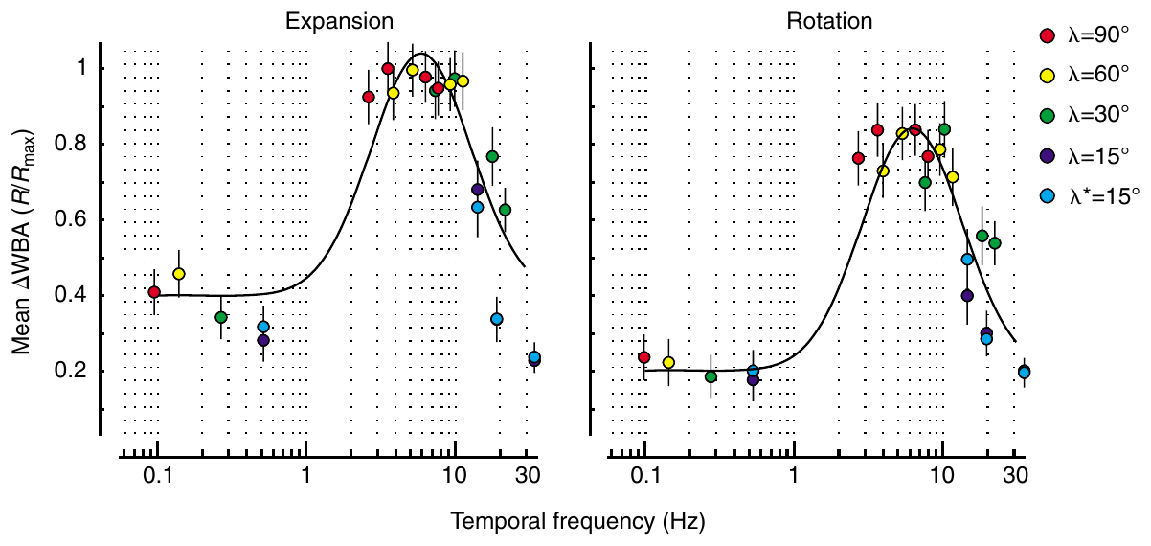
Motion tuning depends on space and time
A grating's spatial wavelength is the angular distance between repeating stripes. Its temporal frequency is the number of pattern cycles passing a retinal position each second. A pattern's speed alone therefore does not specify the stimulation reaching the visual system.
Duistermars and colleagues varied wavelengths from 15° to 90° and pattern speeds from 10 to 431°/s. These combinations sampled approximately 0.11–35.4 Hz while the same flies encountered both expansion and rotation.
Expansion generally elicited stronger steering than rotation, but both responses plateaued at approximately 3–10 Hz and declined near 30 Hz. Comparable temporal tuning is consistent with shared elementary motion processing; different response magnitudes do not establish separate local detectors.
Duistermars et al. (2007), Fig. 3. Expansion and rotation share similar temporal tuning.
Duistermars et al. (2007)
04
Notes:
• Spatial wavelength concerns distance across the eye, whereas temporal frequency concerns the rate at which the pattern repeats at one location. Changing stripe spacing can therefore alter temporal stimulation without changing the speed in degrees per second.
• The experiments combined several spacings with several speeds, rather than testing one grating alone. The same animals supplied responses to expansion and rotation, reducing differences arising from the flight state of different individuals.
• The two flow fields had similar temporal-frequency optima despite different steering amplitudes. A common early detector is one interpretation, but these motor measurements cannot identify particular neurons or determine whether every later pooling stage is shared.
References:
Duistermars BJ, Chow DM, Condro M, Frye MA (2007). The spatial, temporal and contrast properties of expansion and rotation flight optomotor responses in Drosophila. Journal of Experimental Biology 210:3218-3227. https://doi.org/10.1242/jeb.007807
Figure: Duistermars et al. (2007), Fig. 3. Expansion and rotation share similar temporal tuning.
Figure source: https://doi.org/10.1242/jeb.007807

Slide 5
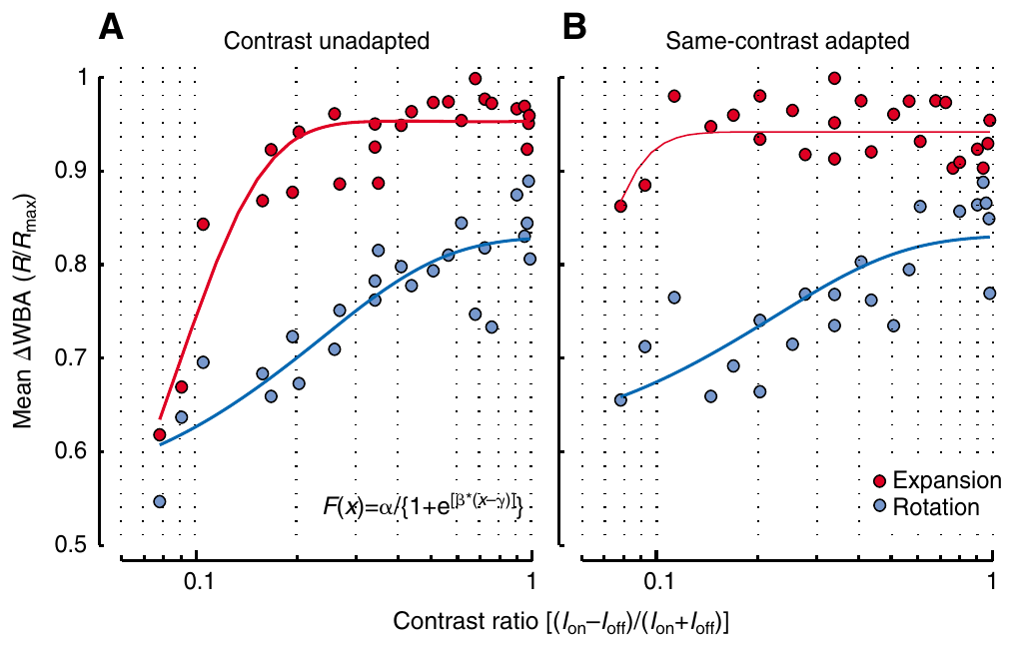
Contrast changes the strength of optomotor turning
Contrast quantifies the difference between bright and dark pattern regions relative to their combined intensity. Duistermars and colleagues varied contrast while holding wavelength at 30° and speed at 232°/s, separating pattern visibility from changes in its motion.
Before an unadapted test, the fly controlled a single stripe. Before an adapted test, it experienced the wide-field test contrast for 7 s. Thus the comparison changed recent visual exposure without changing the subsequent moving pattern.
Expansion steering saturated at lower contrasts than rotational steering in the unadapted condition. Prior contrast exposure altered sensitivity and made the response relationships more nearly linear. Behavioral gain, the response change per stimulus change, depends on recent stimulation as well as motion direction.
Duistermars et al. (2007), Fig. 7. Prior contrast exposure changes steering sensitivity.
Duistermars et al. (2007)
05
Notes:
• Contrast changes the strength of retinal intensity modulation even when stripe spacing and speed remain fixed. The experiment used multiple contrast values and randomized their order, so a difference in steering did not simply reflect increasing contrast through the session.
• The adaptation manipulation placed the animal in the same wide-field contrast before testing it. Seven seconds of prior exposure changed the history of the visual pathway while preserving the properties of the test stimulus.
• Expansion and rotation differed in how rapidly steering approached saturation. The result concerns the complete sensorimotor pathway: it does not localize contrast adaptation to a particular photoreceptor, interneuron or motor neuron.
References:
Duistermars BJ, Chow DM, Condro M, Frye MA (2007). The spatial, temporal and contrast properties of expansion and rotation flight optomotor responses in Drosophila. Journal of Experimental Biology 210:3218-3227. https://doi.org/10.1242/jeb.007807
Figure: Duistermars et al. (2007), Fig. 7. Prior contrast exposure changes steering sensitivity.
Figure source: https://doi.org/10.1242/jeb.007807

Slide 6
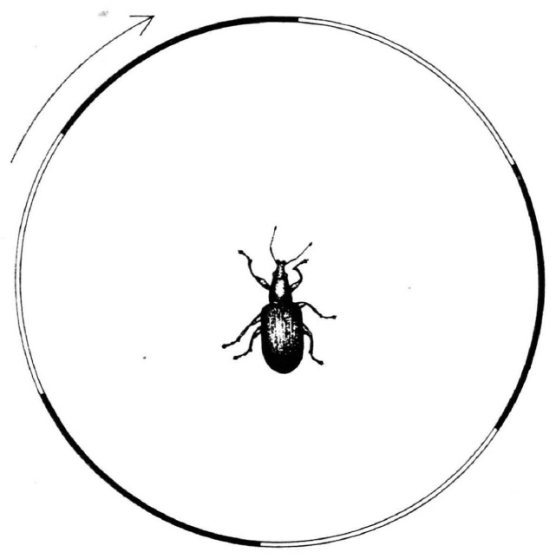
Reichardt's original experiments used a beetle
Hassenstein and Reichardt developed their motion-detection account from the weevil Chlorophanus, not from Drosophila. A striped rotating surround elicited a compensatory turning response, linking the sequence of visual stimulation to a directional behavioral output.
Their 1956 analysis separated the timing, order and sign of local brightness changes. A motion signal required a relationship between neighboring visual inputs: a single location changing brightness did not uniquely specify which direction an object traveled.
The elementary motion detector is a local computation comparing signals from different visual positions over time. Its historical derivation described operations sufficient to explain behavior. Later fly experiments tested that computation and investigated its neural implementation; the beetle experiments did not identify T4 or T5 neurons.
Hassenstein & Reichardt (1956), Fig. 2. A beetle inside the original rotating striped drum.
Hassenstein & Reichardt (1956); Clark et al. (2011)
06
Notes:
• The original animal was a weevil. Hassenstein and Reichardt related compensatory behavior to carefully controlled sequences of local stimulation, rather than reconstructing a fly circuit.
• A luminance change at one location is compatible with several causes, including an object entering, an object leaving or a light source changing intensity. Direction becomes available when responses at different positions are compared in a time-dependent way.
• Elementary means local here: the computation concerns neighboring visual inputs rather than a whole panoramic flow field. The operations inferred from beetle behavior and the cell types subsequently measured in fruit flies are different levels of explanation and different experimental preparations.
References:
Hassenstein B, Reichardt W (1956). Systemtheoretische Analyse der Zeit-, Reihenfolgen- und Vorzeichenauswertung bei der Bewegungsperzeption des Rüsselkäfers Chlorophanus. Zeitschrift für Naturforschung B 11:513–524. https://doi.org/10.1515/znb-1956-9-1004
Clark DA, Bursztyn L, Horowitz MA, Schnitzer MJ, Clandinin TR (2011). Defining the computational structure of the motion detector in Drosophila. Neuron 70:1165-1177. https://doi.org/10.1016/j.neuron.2011.05.023
Figure: Hassenstein & Reichardt (1956), Fig. 2. A beetle inside the original rotating striped drum.
Figure source: https://doi.org/10.1515/znb-1956-9-1004

Slide 7
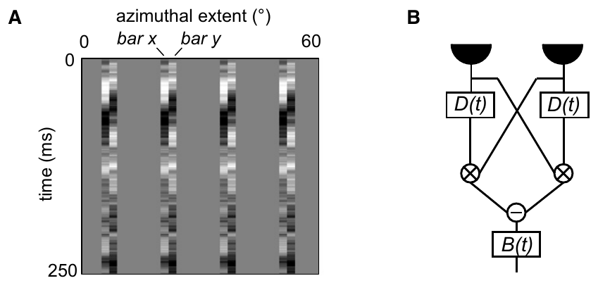
Sequential stimulation supplies directional information
Apparent motion can arise when adjacent visual positions are stimulated successively, even without a continuously moving object. Reversing the order of stimulation changes the available direction cue while leaving the individual locations unchanged.
Clark and colleagues presented independently varying pairs of 2°-wide bars to flies walking on a ball. The repeated bar pairs supplied local intensity sequences without requiring the experimenter to assign a coherent moving feature to every frame.
Turning was related to correlations between neighboring bar intensities separated by approximately 20–30 ms. A correlation here means a joint dependence on the two signals. The timing relationship supports a delayed interaction, rather than a detector responding only to the intensity at one location.
Clark et al. (2011), Fig. 2(A, B). Independent neighboring bars probe a delayed interaction.
Clark et al. (2011); Hassenstein & Reichardt (1956)
07
Notes:
• A pair of neighboring locations can carry a direction cue through their order of activation. Continuous movement is unnecessary when the sequence itself supplies the relevant spatial and temporal relationship.
• The randomly changing bar pairs were useful because each input varied independently. A relationship between turning and the joint input could then be separated from a relationship between turning and either input alone.
• The behavioral analysis identified an effective delay of about twenty to thirty milliseconds. This is a fitted temporal relationship in a sensorimotor response, rather than a measurement of one receptor's kinetics or a direct recording of a named delay neuron.
References:
Clark DA, Bursztyn L, Horowitz MA, Schnitzer MJ, Clandinin TR (2011). Defining the computational structure of the motion detector in Drosophila. Neuron 70:1165-1177. https://doi.org/10.1016/j.neuron.2011.05.023
Hassenstein B, Reichardt W (1956). Systemtheoretische Analyse der Zeit-, Reihenfolgen- und Vorzeichenauswertung bei der Bewegungsperzeption des Rüsselkäfers Chlorophanus. Zeitschrift für Naturforschung B 11:513–524. https://doi.org/10.1515/znb-1956-9-1004
Figure: Clark et al. (2011), Fig. 2(A, B). Independent neighboring bars probe a delayed interaction.
Figure source: https://doi.org/10.1016/j.neuron.2011.05.023

Slide 8
A delayed interaction compares neighboring signals
The Hassenstein–Reichardt correlator compares two neighboring inputs after applying different temporal filtering to them. One signal is delayed relative to the other, allowing a moving pattern's sequential activation to overlap within the computation.
The delayed and less-delayed signals interact multiplicatively: their joint contribution depends on both inputs, rather than their simple sum. A mirror-symmetric arm reverses which spatial input is delayed, and the two arm outputs are subtracted.
Clark's random-bar experiments supported this correlation structure in fly turning, with a fitted delay filter peaking near 25 ms. The diagram is a computational model. A delay box and multiplier do not, by themselves, identify particular neurons, channels or synapses that implement those operations.
Clark et al. (2011), Fig. 2(A, B). The published correlation detector and its visual inputs.
Hassenstein & Reichardt (1956); Clark et al. (2011)
08
Notes:
• Temporal filtering means that an input's contribution depends on its recent history. The two inputs do not need to arrive with the same time course, and motion can bring the less-delayed input into correspondence with the retained earlier input.
• Multiplication makes the interaction sensitive to the presence and sign of both signals. The mirror arm has the opposite spatial arrangement, so subtracting the two arms creates a signed response that distinguishes the two directions.
• The effective twenty-five-millisecond delay was inferred by fitting behavior. The same computation could arise from several combinations of synaptic kinetics, membrane filtering and circuit connections, so the fit does not establish a unique biophysical implementation.
References:
Hassenstein B, Reichardt W (1956). Systemtheoretische Analyse der Zeit-, Reihenfolgen- und Vorzeichenauswertung bei der Bewegungsperzeption des Rüsselkäfers Chlorophanus. Zeitschrift für Naturforschung B 11:513–524. https://doi.org/10.1515/znb-1956-9-1004
Clark DA, Bursztyn L, Horowitz MA, Schnitzer MJ, Clandinin TR (2011). Defining the computational structure of the motion detector in Drosophila. Neuron 70:1165-1177. https://doi.org/10.1016/j.neuron.2011.05.023
Figure: Clark et al. (2011), Fig. 2(A, B). The published correlation detector and its visual inputs.
Figure source: https://doi.org/10.1016/j.neuron.2011.05.023

Slide 9
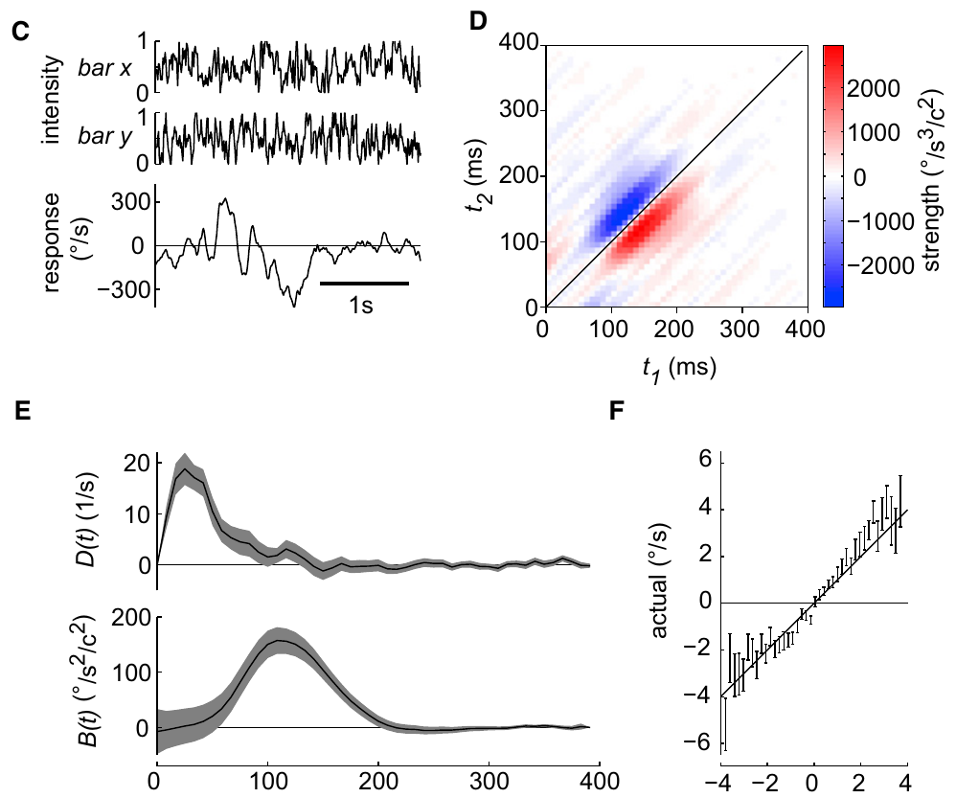
Opponent detector arms distinguish motion direction
An opponent computation subtracts signals favoring opposite alternatives. In the Reichardt detector, the two arms exchange the positions receiving the relative delay. Direction is encoded by their imbalance, rather than by the activity of either arm alone.
Clark and colleagues fitted a two-dimensional temporal kernel, a weighting of earlier input combinations that predicted turning. Neighboring intensities contributed most strongly when separated by 20–30 ms, and the relationship between predicted and measured mean turning was approximately linear.
The fit accounted for only a small fraction of the variability under this weak random-bar stimulus. Agreement with the average directional interaction supports the model's computational structure while leaving substantial behavioral fluctuations and downstream response dynamics unexplained.
Clark et al. (2011), Fig. 2(C, D, E, F). Measured temporal kernel and predicted versus actual turning.
Clark et al. (2011)
09
Notes:
• Opponent subtraction gives the computation a sign. Reversing the spatial sequence exchanges the contributions of the two arms, whereas adding them would discard much of the directional distinction.
• A temporal kernel specifies which combinations of past inputs contribute to a measured response. The investigators also included a behavioral filter, because the motor output has dynamics beyond those of the local detector.
• A model can capture the average relationship while predicting little of the moment-to-moment variation. The weak stimulus produced substantial stimulus-independent turning, so a successful mean fit should not be interpreted as a complete explanation of every turn.
References:
Clark DA, Bursztyn L, Horowitz MA, Schnitzer MJ, Clandinin TR (2011). Defining the computational structure of the motion detector in Drosophila. Neuron 70:1165-1177. https://doi.org/10.1016/j.neuron.2011.05.023
Figure: Clark et al. (2011), Fig. 2(C, D, E, F). Measured temporal kernel and predicted versus actual turning.
Figure source: https://doi.org/10.1016/j.neuron.2011.05.023

Slide 10
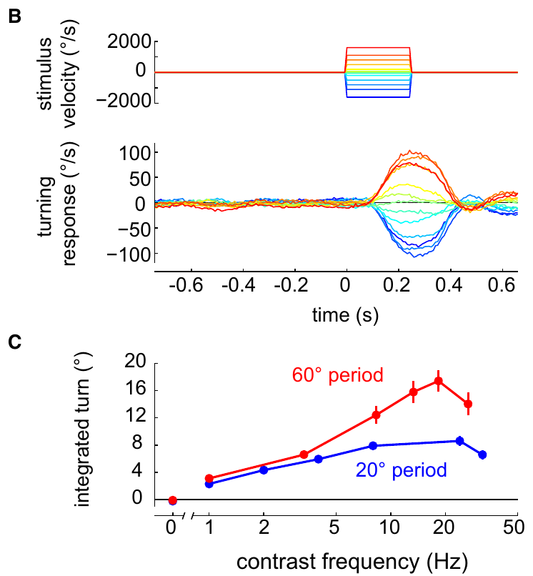
Correlation detectors do not measure velocity alone
An angular velocity reports how many degrees a pattern moves per second. A correlation detector's response also depends on spatial structure and temporal filtering, so it is not a pattern-independent speedometer.
Clark and colleagues measured turning responses to gratings with 20° and 60° spatial periods across multiple temporal frequencies. Turning increased and then declined as temporal frequency rose. Duistermars obtained a comparable band of effective temporal frequencies during tethered flight.
Changing wavelength changes the time between neighboring contrast events at a fixed speed. A detector can therefore respond differently to two patterns moving at the same velocity. Behavioral tuning constrains the overall computation, but it also includes spatial pooling, adaptation and the dynamics of the motor response.
Clark et al. (2011), Fig. 1(B, C). Grating spacing changes the relationship between speed and turning.
Clark et al. (2011); Duistermars et al. (2007)
10
Notes:
• Velocity and temporal frequency are related through stripe spacing. A given angular speed can produce rapid local modulation for narrow stripes and slower modulation for broad stripes.
• The walking and flight experiments both obtained tuning rather than a response that simply increased across all speeds. Very rapid repetition eventually became less effective, consistent with the finite temporal resolution of the pathway.
• These measurements concern a complete behavioral response. The fitted tuning cannot be attributed entirely to one delay element because the animal's optics, multiple neural stages and steering machinery all contribute to the measured curve.
References:
Clark DA, Bursztyn L, Horowitz MA, Schnitzer MJ, Clandinin TR (2011). Defining the computational structure of the motion detector in Drosophila. Neuron 70:1165-1177. https://doi.org/10.1016/j.neuron.2011.05.023
Duistermars BJ, Chow DM, Condro M, Frye MA (2007). The spatial, temporal and contrast properties of expansion and rotation flight optomotor responses in Drosophila. Journal of Experimental Biology 210:3218-3227. https://doi.org/10.1242/jeb.007807
Figure: Clark et al. (2011), Fig. 1(B, C). Grating spacing changes the relationship between speed and turning.
Figure source: https://doi.org/10.1016/j.neuron.2011.05.023

Slide 11
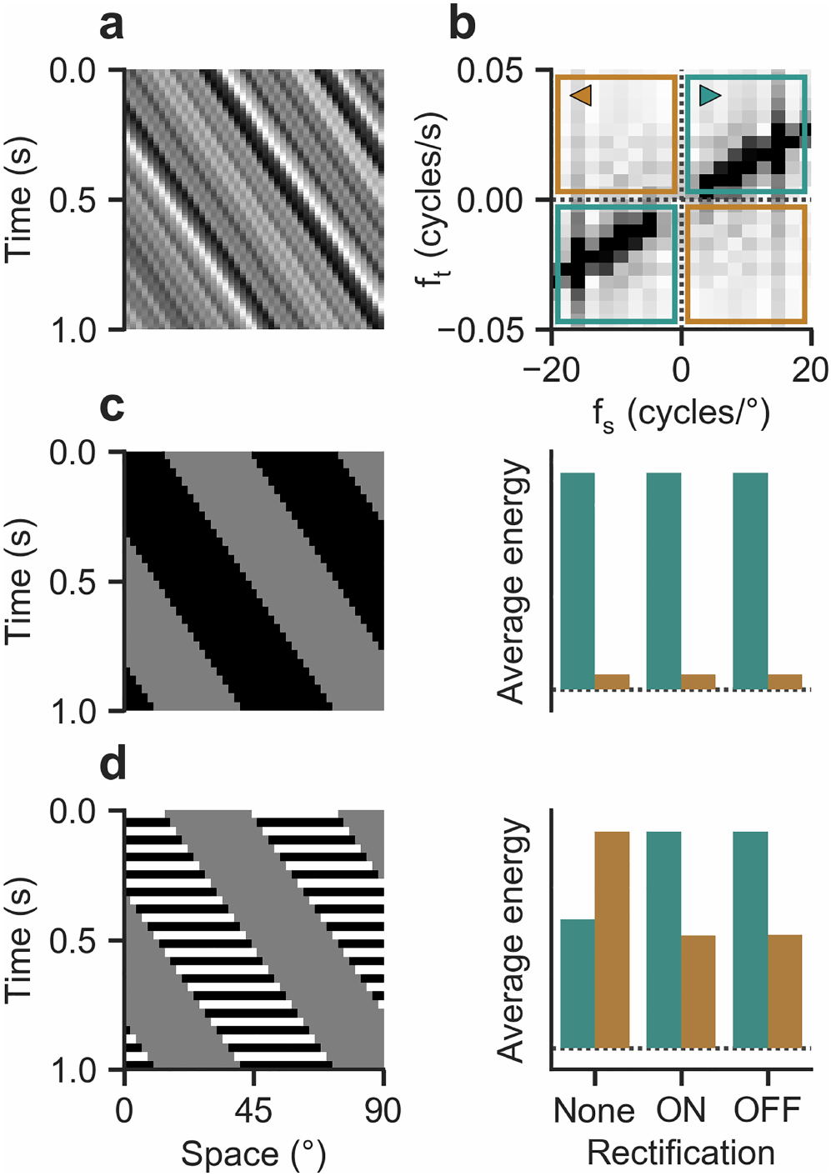
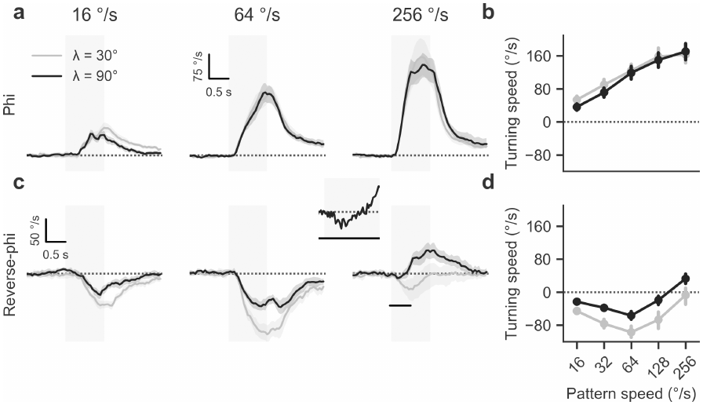
Contrast reversals can reverse perceived motion
In phi motion, a pattern shifts between frames while preserving its contrast. In reverse-phi motion, each shift also reverses bright and dark regions. Physical displacement and the direction signaled by the visual system can then disagree.
Leonhardt and colleagues measured tethered walking during discrete pattern shifts. Ordinary phi elicited turning with the pattern. Reverse-phi elicited turning against it at lower velocities, while sufficiently rapid stimulation could reverse the behavioral response again.
Contrast inversion changes the sign of interactions between neighboring signals in a correlation computation. Reverse-phi therefore probes the detector's operations, rather than simply testing whether the fly can track an identifiable object. The illusion's dependence on velocity limits a single universal prediction of opposite-direction turning.
Leonhardt et al. (2017), Fig. 2(a–f). Contrast-preserving and contrast-reversing apparent-motion stimuli.
Leonhardt et al. (2017), Fig. 3. Measured turning reverses under reverse-phi stimulation.
Leonhardt et al. (2017)
11
Notes:
• The spatial displacement is the same type of event in both conditions. What changes is whether a bright region remains bright after the step or becomes dark. That additional contrast reversal can alter the sign of the motion computation.
• Flies turned against slower reverse-phi patterns, but at high velocities their turning could become aligned with displacement again. The response cannot be described adequately by a rule that every reverse-phi stimulus produces an opposite turn.
• The experiment separates a feature's physical displacement from the signed response of the visual pathway. It supplies a demanding test for models of motion detection because a model must account for both the ordinary response and the stimulus-dependent illusion.
References:
Leonhardt A, Meier M, Serbe E, Eichner H, Borst A (2017). Neural mechanisms underlying sensitivity to reverse-phi motion in the fly. PLoS ONE 12:e0189019. https://doi.org/10.1371/journal.pone.0189019
Figure: Leonhardt et al. (2017), Fig. 2(a–f). Contrast-preserving and contrast-reversing apparent-motion stimuli.
Figure source: https://doi.org/10.1371/journal.pone.0189019
Figure: Leonhardt et al. (2017), Fig. 3. Measured turning reverses under reverse-phi stimulation.
Figure source: https://doi.org/10.1371/journal.pone.0189019

Slide 12
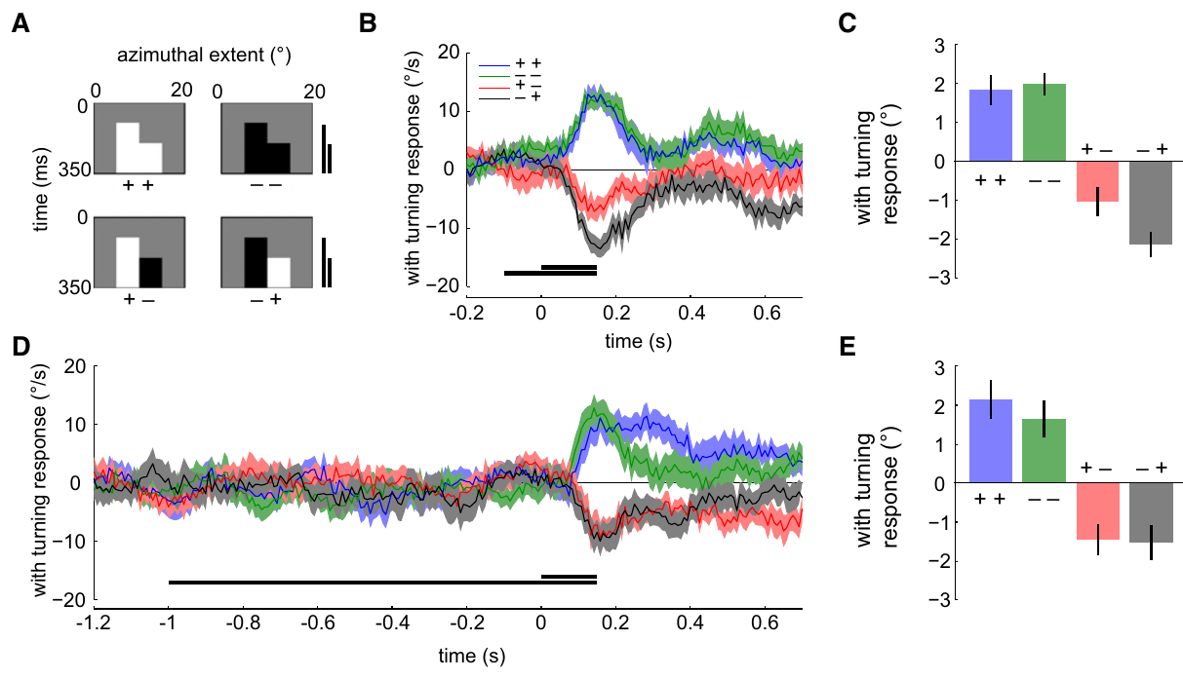
Contrast-polarity tests constrain detector architecture
A contrast polarity specifies whether local brightness increases or decreases relative to a reference. Two successive neighboring events can therefore form four pairings: bright–bright, dark–dark, bright–dark and dark–bright.
Clark and colleagues presented minimal sequential bar pairs while recording ball-based turning. Flies responded to all four pairings. Contrast-preserving sequences favored one directional sign; contrast-reversing sequences favored the opposite sign under the tested timing conditions.
These results constrain how ON and OFF pathways can implement the correlation computation. Processing bright and dark events separately cannot mean that all opposite-polarity influences are absent. Behavioral sensitivity identifies effective operations, but it does not establish the membrane mechanism or exact synaptic site of each interaction.
Clark et al. (2011), Fig. 6. All four contrast-pair sequences influence fly turning.
Clark et al. (2011)
12
Notes:
• The four pairings exhaust the signs of two local brightness changes. They distinguish computations that correlate same-polarity signals from computations that are also sensitive to opposite-polarity relationships.
• The minimal stimuli were controlled sequences of neighboring bars. Changing the polarity combination changed the direction of the response while preserving the basic two-location arrangement.
• Separate pathways can have preferences without becoming completely independent of the other polarity. The behavioral data require effective sensitivity to opposite-sign events, but they do not specify whether that sensitivity arises from baseline activity, inhibition or another circuit operation.
References:
Clark DA, Bursztyn L, Horowitz MA, Schnitzer MJ, Clandinin TR (2011). Defining the computational structure of the motion detector in Drosophila. Neuron 70:1165-1177. https://doi.org/10.1016/j.neuron.2011.05.023
Figure: Clark et al. (2011), Fig. 6. All four contrast-pair sequences influence fly turning.
Figure source: https://doi.org/10.1016/j.neuron.2011.05.023

Slide 13
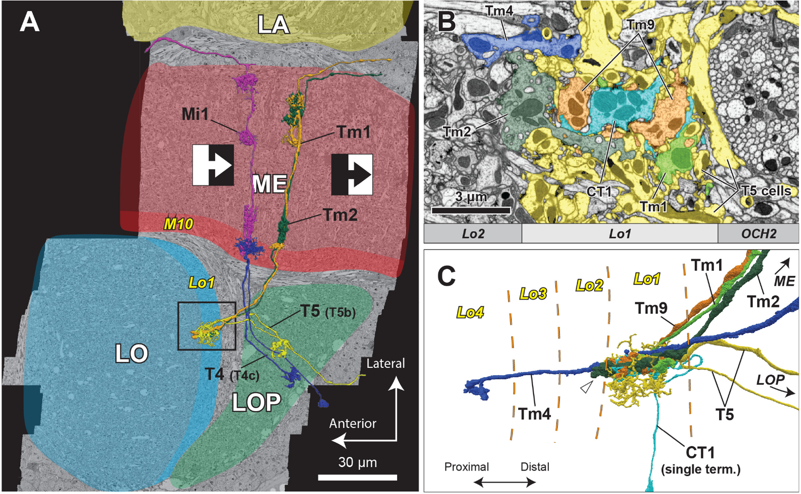
The fly optic lobe preserves visual position
The optic lobe contains successive visual processing regions beside the central brain. A neuropil is a region rich in neuronal processes and synapses. The fly's major optic neuropils are the lamina, medulla, lobula and lobula plate.
Retinotopy preserves the neighborhood relationships of visual positions within neural tissue. Repeated columns carry signals associated with neighboring locations, so local motion can be computed by comparing inputs from adjacent columns rather than losing spatial identity immediately.
Shinomiya and colleagues reconstructed neurons and synapses with focused-ion-beam scanning electron microscopy. T4 dendrites occupy medulla layer M10, whereas T5 dendrites occupy lobula layer Lo1. Their axons converge in the lobula plate. Anatomical position distinguishes the two processing routes but does not establish their temporal response properties.
Shinomiya et al. (2019), Fig. 1. Reconstructed neurons traverse the optic-lobe neuropils.
Takemura et al. (2017); Shinomiya et al. (2019)
13
Notes:
• Neuropils contain the branching processes where visual neurons communicate. The lamina is the first optic neuropil, followed by deeper processing in the medulla and lobula complex.
• Retinotopy means that neighboring locations in visual space remain neighbors in the neural representation. Repeated columns preserve enough spatial organization for a neuron to compare signals displaced across the visual field.
• Electron microscopy traced the two motion pathways through different dendritic compartments. T4 receives inputs in M10 and T5 in Lo1, while both send output to the lobula plate. The reconstruction identifies connections and spatial arrangement; physiological measurements are required to determine filtering and response sign.
References:
Takemura SY, Nern A, Chklovskii DB, Scheffer LK, Rubin GM, Meinertzhagen IA (2017). The comprehensive connectome of a neural substrate for 'ON' motion detection in Drosophila. eLife 6:e24394. https://doi.org/10.7554/elife.24394
Shinomiya K, Huang G, Lu Z, Parag T, Xu CS, Aniceto R, Ansari N, Cheatham N, Lauchie S, Neace E, Ogundeyi O, Ordish C, Peel D, Shinomiya A, Smith C, Takemura S, Talebi I, Rivlin PK, Nern A, Scheffer LK, Plaza SM, Meinertzhagen IA (2019). Comparisons between the ON- and OFF-edge motion pathways in the Drosophila brain. eLife 8:e40025. https://doi.org/10.7554/elife.40025
Figure: Shinomiya et al. (2019), Fig. 1. Reconstructed neurons traverse the optic-lobe neuropils.
Figure source: https://doi.org/10.7554/elife.40025

Slide 14
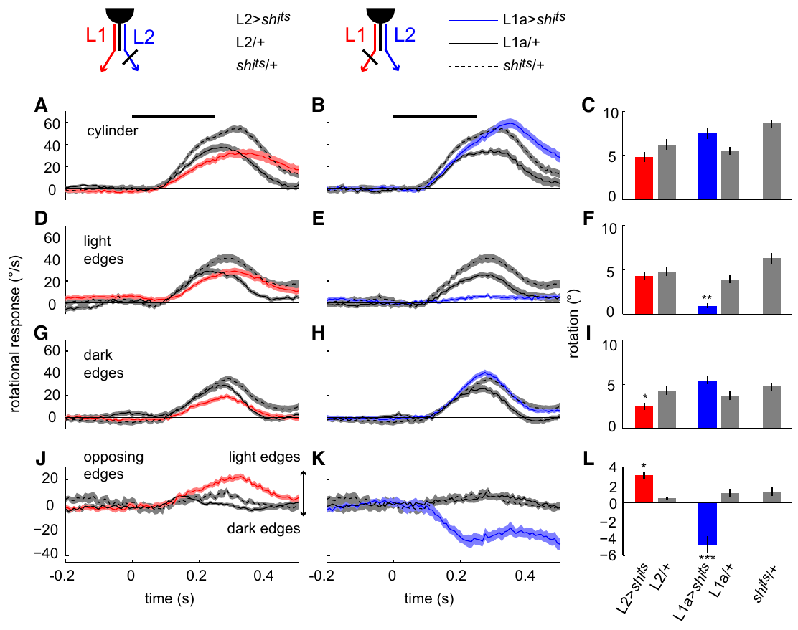
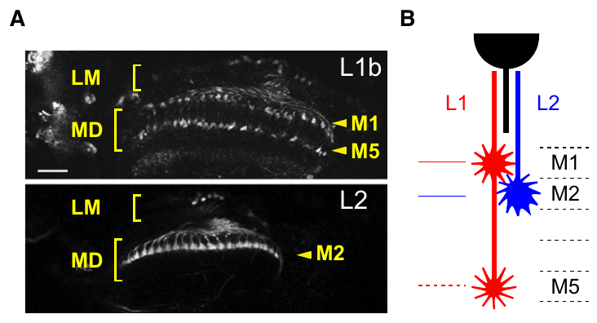
Lamina pathways divide luminance-change signals
Luminance is the light intensity represented at a visual location. Lamina neurons L1 and L2 relay signals from the outer photoreceptors R1–R6 into the medulla. Their axon terminals occupy different medulla layers. Photoreceptor histamine, a neurotransmitter, activates chloride channels in L1/L2 and inverts the light response: increased brightness reduces terminal calcium.
Clark and colleagues used shibire, a temperature-sensitive interference with synaptic vesicle recycling, to suppress output from selected neurons. They compared experimental flies with driver-only and effector-only controls while presenting isolated light edges, dark edges or opposing edges.
L1-associated processing favored light-edge motion, whereas L2-associated processing favored dark-edge motion. Both pathways retained overlapping computations, and their terminal calcium signals were not simply opposite-polarity channels. The behavioral division cannot be inferred solely from the sign of a lamina neuron's response to light.
Clark et al. (2011), Fig. 4(A, B). L1/L2 terminals.
Clark et al. (2011), Fig. 3. Silencing L1 or L2 changes edge-polarity steering.
Clark et al. (2011); Takemura et al. (2017)
14
Notes:
• L1 and L2 are relay neurons between the photoreceptors and medulla circuits. Their terminal locations differ, so the same visual position can supply distinct downstream pathways. Histamine-gated chloride channels invert the photoreceptor signal, consistent with decreased L1 and L2 terminal calcium when brightness increases.
• The temperature-sensitive shibire manipulation reduces synaptic output rather than removing the neuron. Genetic controls are necessary because temperature, driver expression and the effector construct can influence behavior independently of the intended block.
• Isolated-edge stimuli separated preferences that would be hidden in a conventional grating containing both light and dark edges. The L1 route favored bright-edge motion and the L2 route favored dark-edge motion, but the investigators measured overlapping sensitivity and similar light-evoked calcium responses at the relay stage.
References:
Clark DA, Bursztyn L, Horowitz MA, Schnitzer MJ, Clandinin TR (2011). Defining the computational structure of the motion detector in Drosophila. Neuron 70:1165-1177. https://doi.org/10.1016/j.neuron.2011.05.023
Takemura SY, Nern A, Chklovskii DB, Scheffer LK, Rubin GM, Meinertzhagen IA (2017). The comprehensive connectome of a neural substrate for 'ON' motion detection in Drosophila. eLife 6:e24394. https://doi.org/10.7554/elife.24394
Figure: Clark et al. (2011), Fig. 3. Silencing L1 or L2 changes edge-polarity steering.
Figure source: https://doi.org/10.1016/j.neuron.2011.05.023
Figure: Clark et al. (2011), Fig. 4(A, B). L1/L2 terminals.
Figure source: https://doi.org/10.1016/j.neuron.2011.05.023

Slide 15
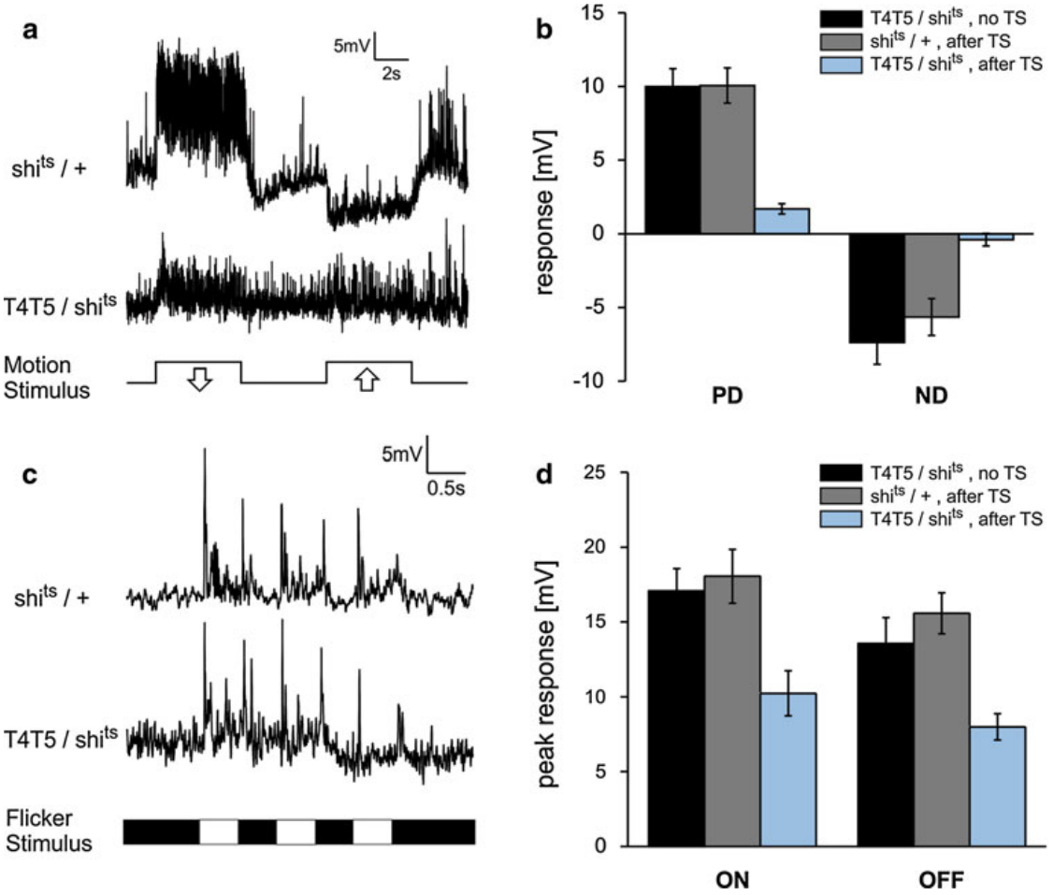
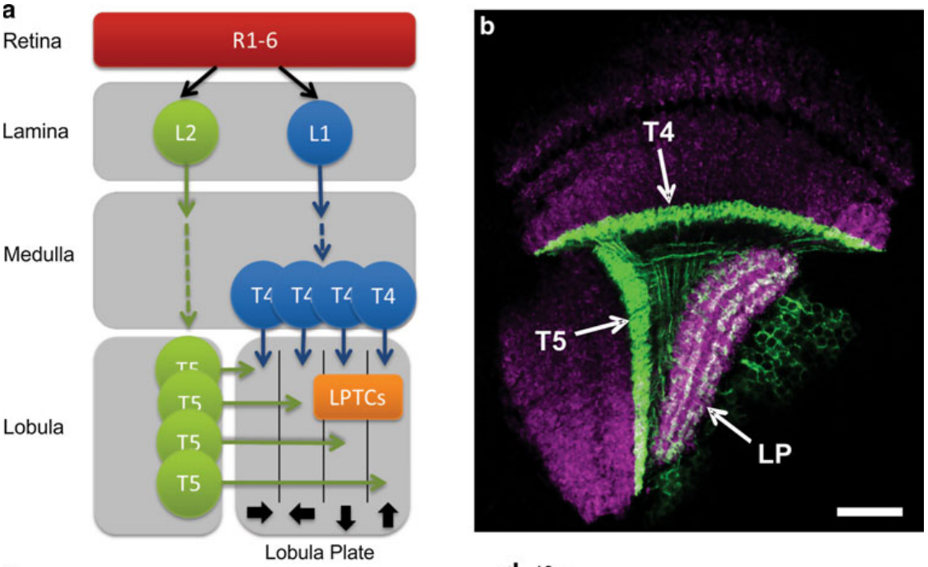
T4 and T5 provide local direction-selective signals
T4 and T5 are repeated small-field neurons linking earlier visual pathways to the lobula plate. A direction-selective neuron responds differently to opposite motion directions through the same region of visual space. T4 and T5 supply direction-selective signals to larger visual interneurons.
Schnell and colleagues recorded membrane voltage from lobula plate tangential cells while suppressing T4/T5 output with temperature-sensitive shibire. A tangential cell extends processes across many visual columns, allowing comparison between a local input population and a wide-field response.
Motion-evoked depolarization and hyperpolarization were largely abolished during the block, whereas flicker responses remained. A flicker changes brightness without ordered spatial displacement. The selective loss supports a necessary motion input from T4/T5 rather than complete failure of the recorded neuron.
Schnell et al. (2012), Fig. 1(a, b). T4/T5 anatomy.
Schnell et al. (2012), Fig. 2(a–d). Motion responses disappear while flicker responses persist.
Schnell et al. (2012)
15
Notes:
• T4 and T5 repeat across the visual field, and each neuron samples a relatively small region. Tangential cells receive from many such local detectors and therefore respond to much larger patterns.
• Membrane voltage was recorded directly while the experimenter blocked T4/T5 synaptic output. The important comparison is between motion and flicker in the same pathway, rather than between different animals responding to unrelated tasks.
• The persistence of flicker responses means that the tangential cells were still capable of responding to visual stimulation. Their loss of directional motion responses specifically implicates T4/T5 transmission, although this manipulation blocks the two cell classes together and does not assign a separate role to each.
References:
Schnell B, Raghu SV, Nern A, Borst A (2012). Columnar cells necessary for motion responses of wide-field visual interneurons in Drosophila. Journal of Comparative Physiology A 198:389-395. https://doi.org/10.1007/s00359-012-0716-3
Figure: Schnell et al. (2012), Fig. 2(a–d). Motion responses disappear while flicker responses persist.
Figure source: https://doi.org/10.1007/s00359-012-0716-3
Figure: Schnell et al. (2012), Fig. 1(a, b). T4/T5 anatomy.
Figure source: https://doi.org/10.1007/s00359-012-0716-3

Slide 16
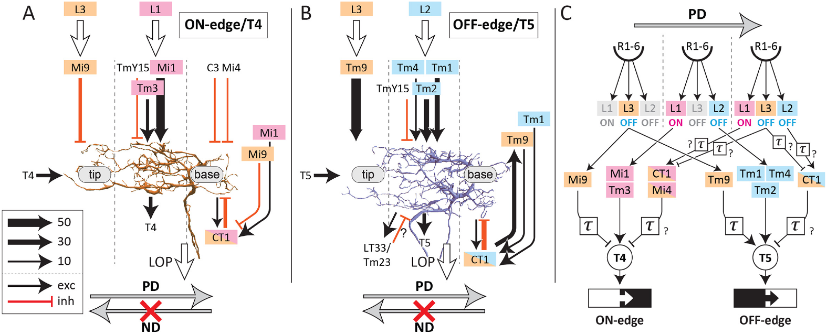
Bright and dark edges use parallel motion pathways
An ON edge increases brightness as it passes a visual location; an OFF edge decreases it. The fly processes these motion signals through parallel pathways: T4 primarily carries ON-edge motion and T5 primarily carries OFF-edge motion.
Serial electron microscopy places the T4 and T5 input networks in M10 and Lo1, respectively. T4 receives medulla inputs including Mi1 and Tm3; T5 receives inputs including Tm1, Tm2, Tm4 and Tm9. Each pathway samples spatially arranged signals rather than a single intensity measurement.
Haag and colleagues measured direction-dependent calcium responses in both pathways. Parallel organization refers to different input populations and edge preferences, not to completely isolated computations. Opposite-polarity influences and baseline signals can still contribute to a neuron preferentially driven by one edge sign.
Shinomiya et al. (2019), Fig. 6. ON and OFF inputs converge onto distinct dendrites.
Haag et al. (2017); Shinomiya et al. (2019)
16
Notes:
• ON and OFF describe changes at a fixed visual location, rather than two classes of permanently bright and dark objects. A bright object can create an ON edge at its front and an OFF edge at its rear.
• The two pathways converge on different dendrites before their axons enter the lobula plate. Their input populations are different, but the spatial arrangement of those inputs permits comparable local comparisons.
• Edge preference is a property of the measured motion response. It should not be treated as proof that every synaptic input has been rectified into only one contrast sign or that the pathway is insensitive to changes of the other sign.
References:
Haag J, Mishra A, Borst A (2017). A common directional tuning mechanism of Drosophila motion-sensing neurons in the ON and in the OFF pathway. eLife 6:e29044. https://doi.org/10.7554/elife.29044
Shinomiya K, Huang G, Lu Z, Parag T, Xu CS, Aniceto R, Ansari N, Cheatham N, Lauchie S, Neace E, Ogundeyi O, Ordish C, Peel D, Shinomiya A, Smith C, Takemura S, Talebi I, Rivlin PK, Nern A, Scheffer LK, Plaza SM, Meinertzhagen IA (2019). Comparisons between the ON- and OFF-edge motion pathways in the Drosophila brain. eLife 8:e40025. https://doi.org/10.7554/elife.40025
Figure: Shinomiya et al. (2019), Fig. 6. ON and OFF inputs converge onto distinct dendrites.
Figure source: https://doi.org/10.7554/elife.40025

Slide 17
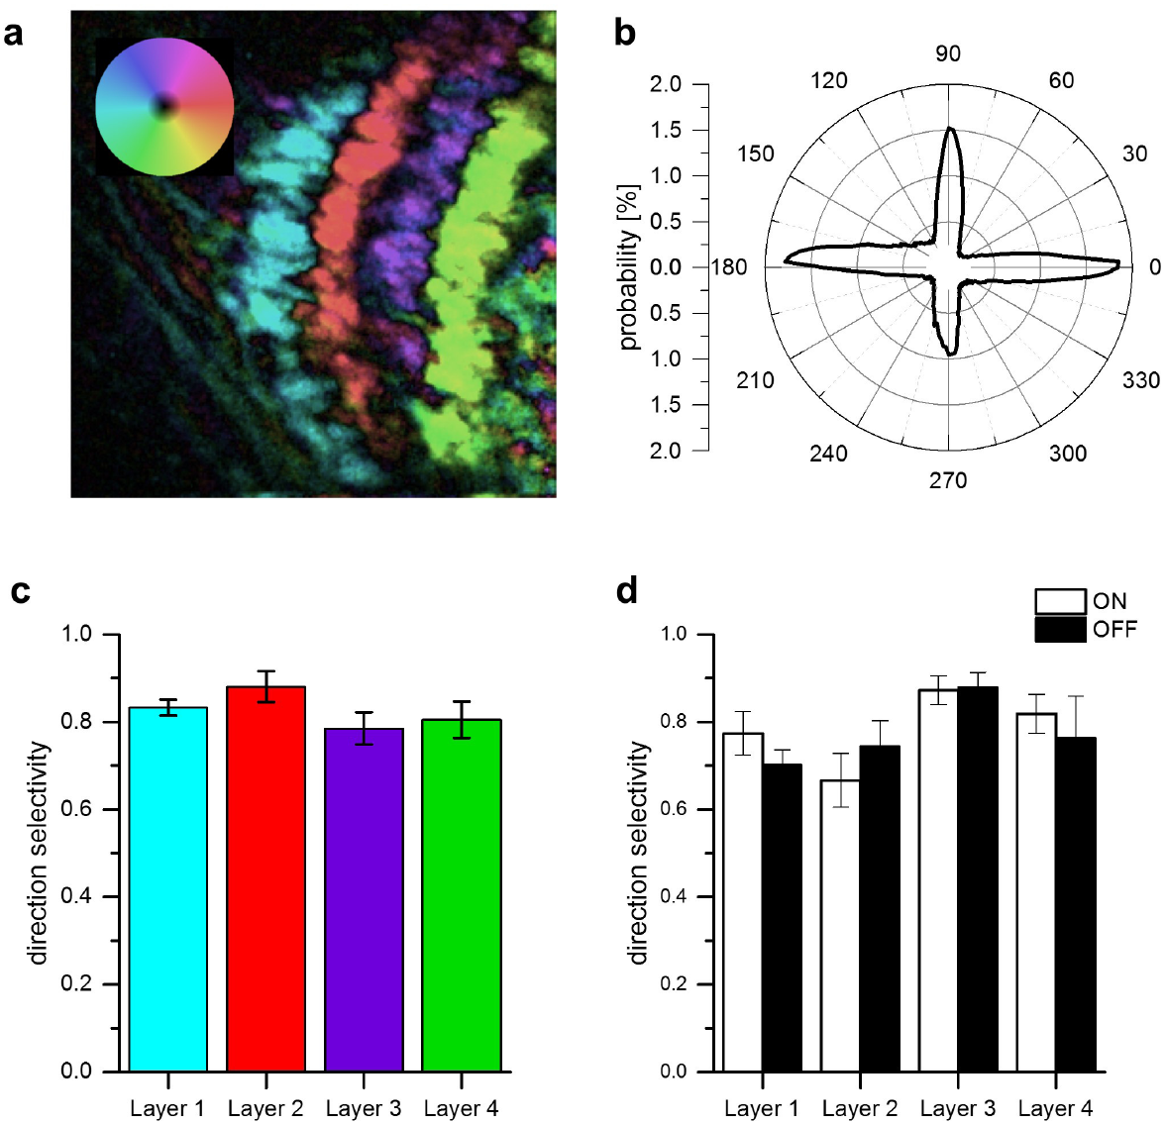
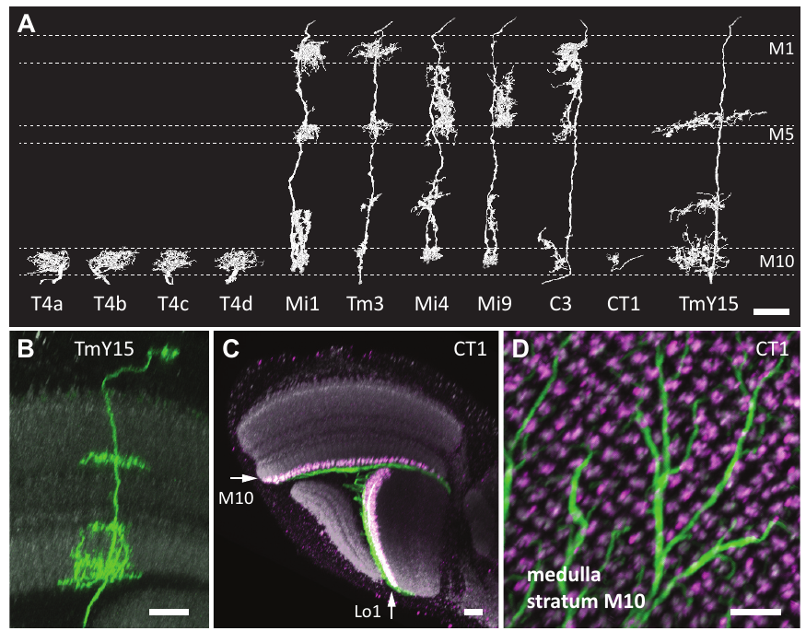
Four neuron subtypes encode four motion directions
T4 and T5 each comprise four directional subtypes. Their axons terminate in four lobula plate layers representing front-to-back, back-to-front, upward and downward motion. A preferred direction produces the stronger response; its opposite is the null direction.
Haag and colleagues imaged calcium signals while gratings moved in different directions. Each layer contained neurons with a corresponding tuning preference, and both ON and OFF neurons contributed to the same layer-specific direction representation.
The layers organize motion direction rather than contrast polarity: matching T4 and T5 subtypes converge despite their different edge preferences. Takemura's electron-microscopic reconstructions distinguish the T4 subtypes anatomically. Combining reconstruction with functional tuning links dendritic organization to a direction-specific output channel.
Haag et al. (2017), Fig. 4. Directional tuning across four output layers.
Takemura et al. (2017), Fig. 2(A–D). Reconstructed T4 subtypes and optic-lobe anatomy.
Haag et al. (2017); Takemura et al. (2017)
17
Notes:
• The four layers contain a set of directional channels repeated across the visual field. Within a layer, signals from bright-edge and dark-edge detectors share a directional preference.
• Preferred direction is defined from the response, not from the visual stimulus alone. The null direction is the opposite motion axis for that particular neuron; it can evoke a weak response or suppress activity depending on the cell and stimulus.
• Calcium imaging assigns functional tuning, whereas electron microscopy traces the corresponding processes. Those methods answer complementary questions: which direction activates the neuron, and where its inputs and outputs are located.
References:
Haag J, Mishra A, Borst A (2017). A common directional tuning mechanism of Drosophila motion-sensing neurons in the ON and in the OFF pathway. eLife 6:e29044. https://doi.org/10.7554/elife.29044
Takemura SY, Nern A, Chklovskii DB, Scheffer LK, Rubin GM, Meinertzhagen IA (2017). The comprehensive connectome of a neural substrate for 'ON' motion detection in Drosophila. eLife 6:e24394. https://doi.org/10.7554/elife.24394
Figure: Haag et al. (2017), Fig. 4. Directional tuning across four output layers.
Figure source: https://doi.org/10.7554/elife.29044
Figure: Takemura et al. (2017), Fig. 2(A–D). Reconstructed T4 subtypes and optic-lobe anatomy.
Figure source: https://doi.org/10.7554/elife.24394

Slide 18
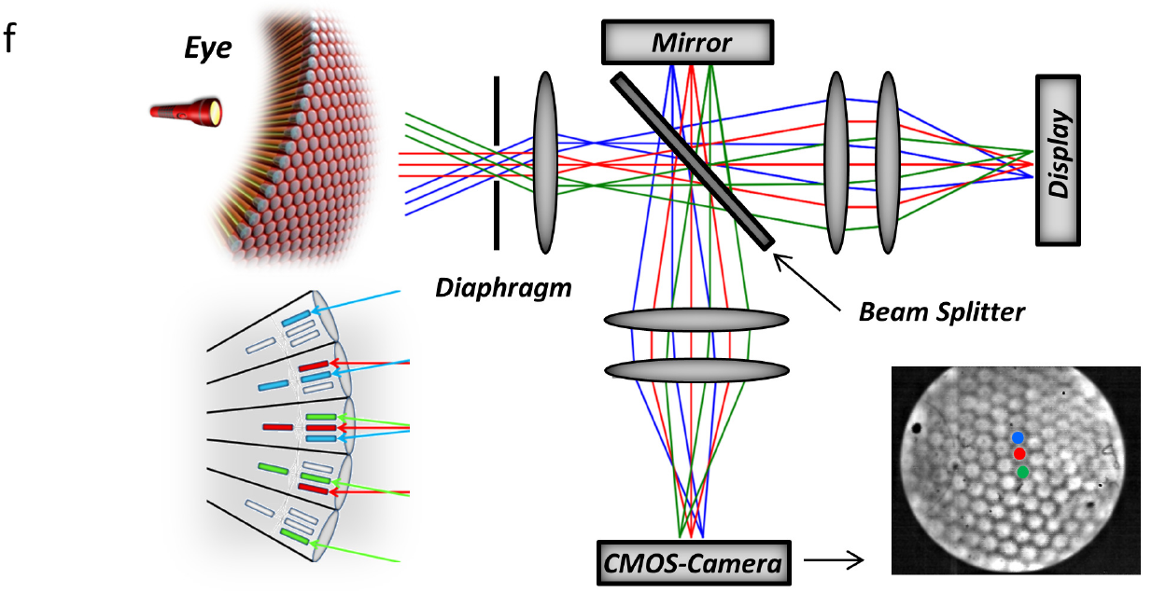
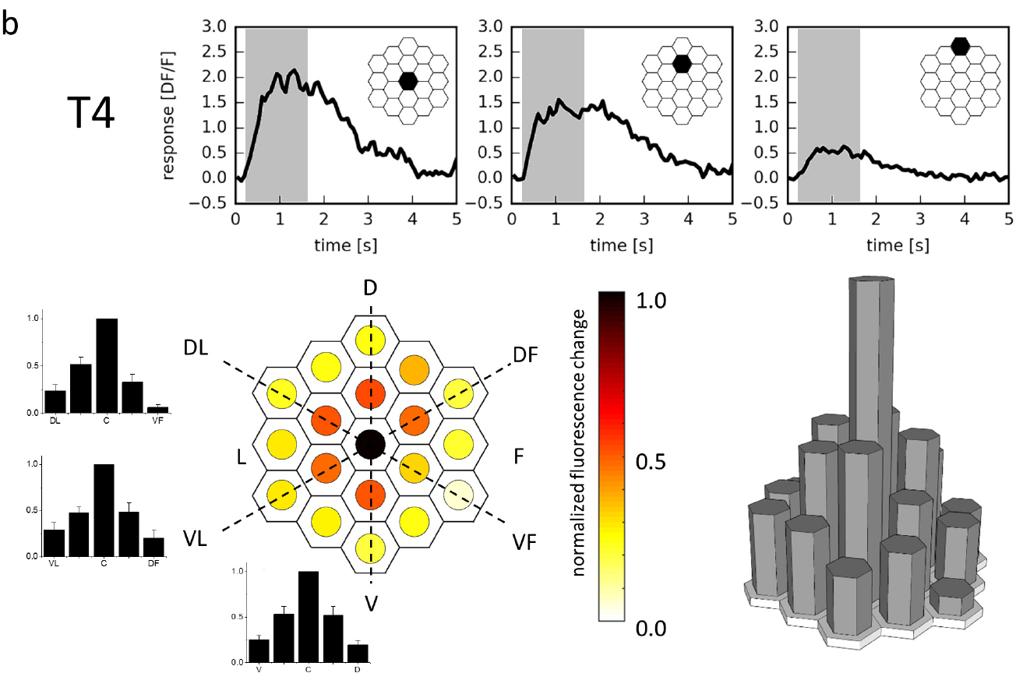
Calcium imaging resolves individual receptive fields
A receptive field is the set of visual positions influencing a neuron's response. Haag and colleagues stimulated individual ommatidia, the repeated optical units of the compound eye, while imaging T4/T5 terminals in the lobula plate.
A custom optical system directed light to selected positions among 716 points covering approximately 60° by 60°. GCaMP6m, a genetically encoded fluorescent calcium indicator, reported activity as ΔF/F, the fluorescence change relative to its baseline.
T4 neurons responded most strongly near the receptive-field center and less strongly at neighboring positions. Mapping isolated local responses established a reference for sequence experiments. Calcium fluorescence reports a consequence of cellular activity; it is not a direct measurement of membrane voltage or synaptic current.
Haag et al. (2016), Fig. 1(f). Single-ommatidium stimulation optics.
Haag et al. (2016), Fig. 2(b). Measured T4 receptive field and local calcium responses.
Haag et al. (2016)
18
Notes:
• Each ommatidium samples a restricted direction in visual space. Directing stimulation to individual optical units gives more precise spatial control than moving a broad grating alone.
• GCaMP changes fluorescence when intracellular calcium changes. Normalizing the change to baseline fluorescence allows responses from labeled terminals to be compared while preserving the source's ΔF/F measurement scale.
• A receptive-field map describes how different positions influence the measured response. Testing locations individually is essential before interpreting a sequence, because a stronger sequence response could otherwise reflect unequal sensitivity to its component locations rather than a nonlinear interaction.
References:
Haag J, Arenz A, Serbe E, Gabbiani F, Borst A (2016). Complementary mechanisms create direction selectivity in the fly. eLife 5:e17421. https://doi.org/10.7554/elife.17421
Figure: Haag et al. (2016), Fig. 1(f). Single-ommatidium stimulation optics.
Figure source: https://doi.org/10.7554/elife.17421
Figure: Haag et al. (2016), Fig. 2(b). Measured T4 receptive field and local calcium responses.
Figure source: https://doi.org/10.7554/elife.17421

Slide 19
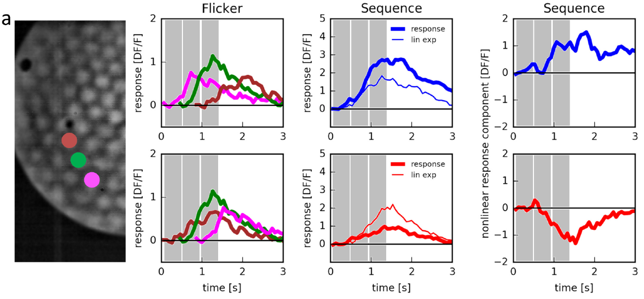
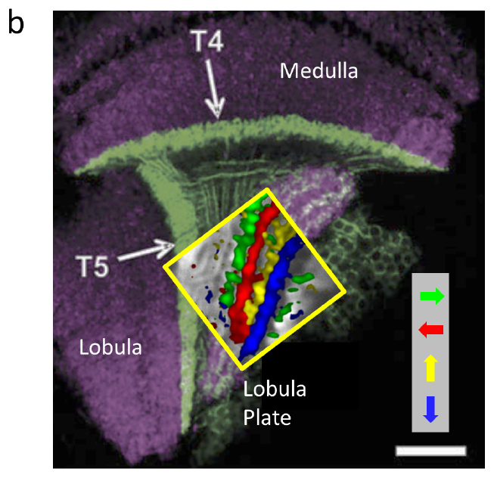
T4 responses depend on the order of local stimulation
A linear prediction adds the responses to separately presented inputs. Haag and colleagues first measured flashes at three neighboring locations, then compared their sum with the response when the same locations were stimulated in a motion sequence.
Preferred-direction sequences produced a measured T4 calcium response larger than the linear prediction. Reversing the order produced a smaller response than predicted, despite using the same spatial positions. The order-dependent difference is a nonlinear interaction, because addition alone cannot reproduce it.
Subtracting the linear prediction from the measured response separated enhancement from suppression. The experiment locates direction-dependent computation at or before T4 output, but calcium imaging alone cannot identify the exact synaptic conductance generating the nonlinear component.
Haag et al. (2016), Fig. 3(a). Single-location controls and sequential T4 responses.
Haag et al. (2016), Fig. 1(b). T4/T5 anatomical compartments.
Haag et al. (2016)
19
Notes:
• Separate flashes supply the control responses for each location. Their sum is the response expected if the neuron combined the inputs independently and linearly.
• Changing only the order changes the motion direction while retaining the tested positions. T4 responses exceeded the sum for one order and fell below it for the reverse order, so the directional effect cannot be reduced to unequal brightness or a stronger central flash.
• The nonlinear component is an analytical difference between measured responses, not an extra biological signal recorded at a synapse. It constrains how the pathway combines inputs, while leaving the membrane and synaptic implementation to other experiments.
References:
Haag J, Arenz A, Serbe E, Gabbiani F, Borst A (2016). Complementary mechanisms create direction selectivity in the fly. eLife 5:e17421. https://doi.org/10.7554/elife.17421
Figure: Haag et al. (2016), Fig. 3(a). Single-location controls and sequential T4 responses.
Figure source: https://doi.org/10.7554/elife.17421
Figure: Haag et al. (2016), Fig. 1(b). T4/T5 anatomical compartments.
Figure source: https://doi.org/10.7554/elife.17421

Slide 20
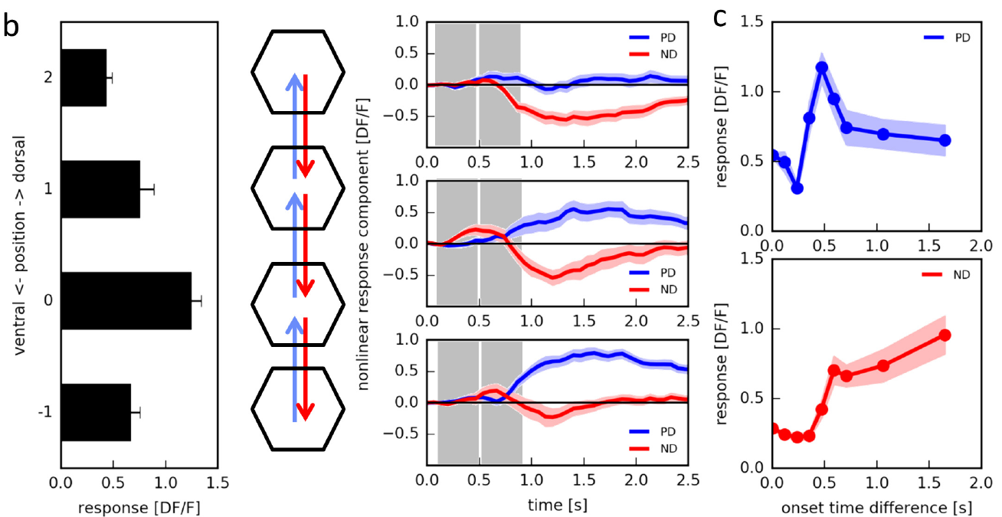
Preferred-direction stimulation enhances responses
Preferred-direction enhancement means that a spatial sequence produces more activity than expected from adding its individual inputs. Haag and colleagues varied which positions were paired and the interval between them while monitoring T4 calcium signals.
Enhancement depended on the position of the preceding stimulus relative to the receptive-field center. Its largest measured contribution occurred at an onset separation near 0.1 s; changing the interval weakened the effect. The directional interaction therefore has both spatial and temporal structure.
A delayed excitatory interaction is consistent with a Reichardt-like enhancement mechanism. The response excess does not prove that two neurons perform a literal arithmetic multiplication, nor does the effective stimulus interval identify a single channel's opening time.
Haag et al. (2016), Fig. 3(b, c). Position and timing affect the nonlinear response.
Haag et al. (2016), Fig. 1(b). T4/T5 anatomical compartments.
Haag et al. (2016)
20
Notes:
• The enhancement is defined relative to individually measured flashes. It concerns the additional response contributed by their sequence, rather than a simple comparison between strong and weak stimulation.
• Only particular spatial pairings produced strong enhancement, and the timing between the inputs also mattered. The roughly one-tenth-second optimum belongs to this calcium-imaging stimulus protocol, not to every effective delay previously fitted from behavior.
• A computational multiplier describes an input-output relationship. Several membrane and synaptic interactions can generate supralinear responses, so matching that relationship is evidence for the operation without uniquely identifying its implementation.
References:
Haag J, Arenz A, Serbe E, Gabbiani F, Borst A (2016). Complementary mechanisms create direction selectivity in the fly. eLife 5:e17421. https://doi.org/10.7554/elife.17421
Figure: Haag et al. (2016), Fig. 3(b, c). Position and timing affect the nonlinear response.
Figure source: https://doi.org/10.7554/elife.17421
Figure: Haag et al. (2016), Fig. 1(b). T4/T5 anatomical compartments.
Figure source: https://doi.org/10.7554/elife.17421

Slide 21
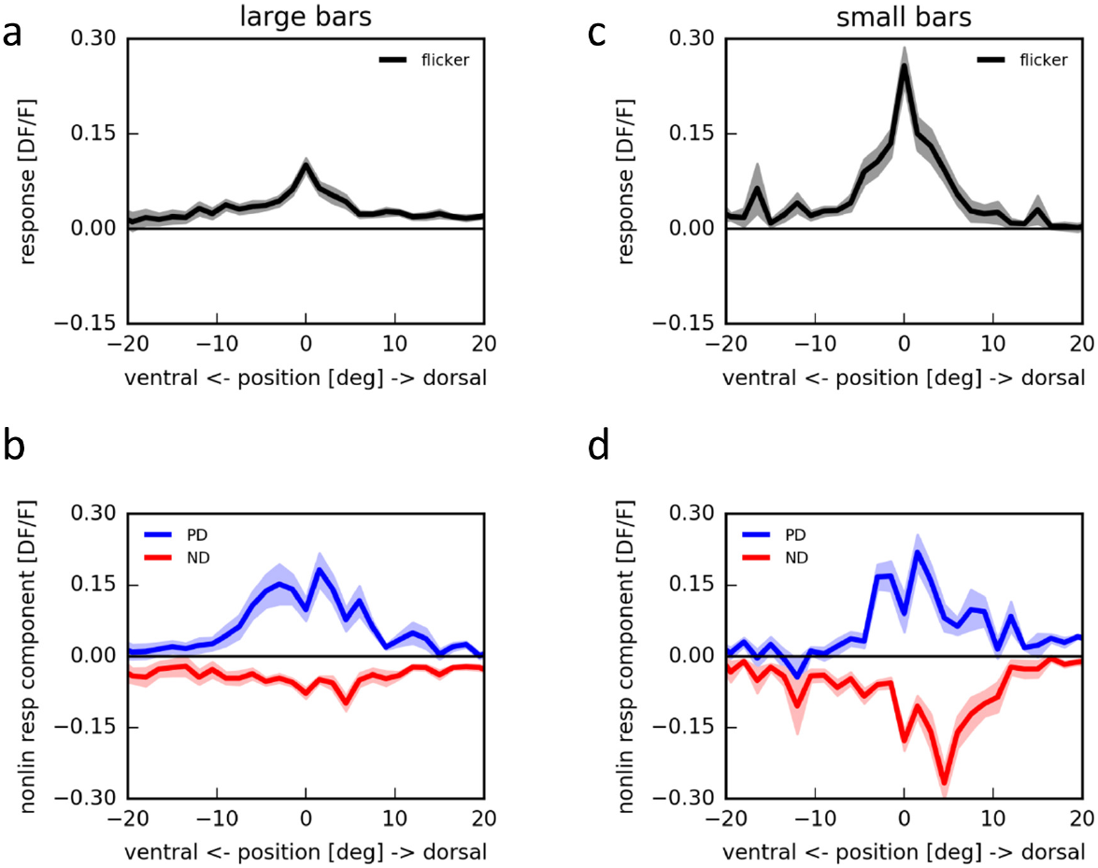
Null-direction stimulation suppresses responses
Null-direction suppression occurs when the reverse spatial sequence reduces a neuron's response below the linear prediction. Haag and colleagues measured this effect both with targeted ommatidium stimulation and with bars on an LED arena.
On the arena, isolated bars identified positions that excited T4. Sequential stimulation could nevertheless produce a negative nonlinear component for motion in the null direction. A response to one component therefore does not determine the response to its pairing with another.
Suppression is compatible with an inhibitory or divisive interaction, but the calcium response alone does not distinguish those biophysical possibilities. It complements preferred-direction enhancement: directional tuning can reflect both an increased response to one sequence and a reduced response to its reverse.
Haag et al. (2016), Fig. 1(b). T4/T5 anatomical compartments.
Haag et al. (2016), Fig. 4. Sequential bars produce below-linear null-direction responses.
Haag et al. (2016)
21
Notes:
• A negative nonlinear component means that the measured sequence response is smaller than the sum of its component responses. It does not necessarily mean that the absolute calcium signal is below baseline.
• Repeating the experiment with an LED arena provided a second stimulation method. The arrangement retained separate flash controls, so reduced sequence activity could be related to the same local inputs tested individually.
• Enhancement and suppression make different contributions to directional tuning. Suppression may involve inhibitory input or another interaction that reduces the effective excitation, but a fluorescence recording does not measure the synaptic current needed to choose uniquely between those mechanisms.
References:
Haag J, Arenz A, Serbe E, Gabbiani F, Borst A (2016). Complementary mechanisms create direction selectivity in the fly. eLife 5:e17421. https://doi.org/10.7554/elife.17421
Figure: Haag et al. (2016), Fig. 4. Sequential bars produce below-linear null-direction responses.
Figure source: https://doi.org/10.7554/elife.17421
Figure: Haag et al. (2016), Fig. 1(b). T4/T5 anatomical compartments.
Figure source: https://doi.org/10.7554/elife.17421

Slide 22
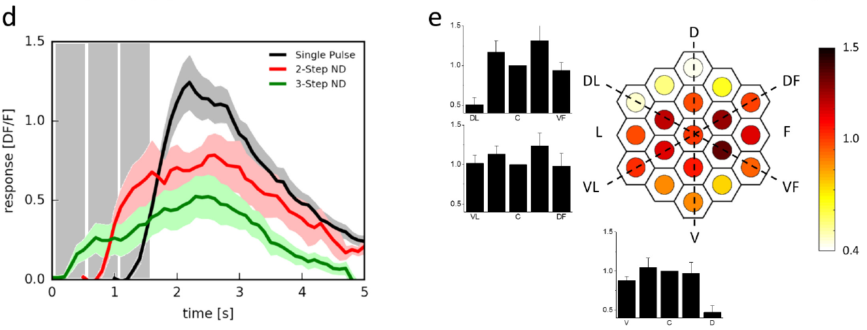
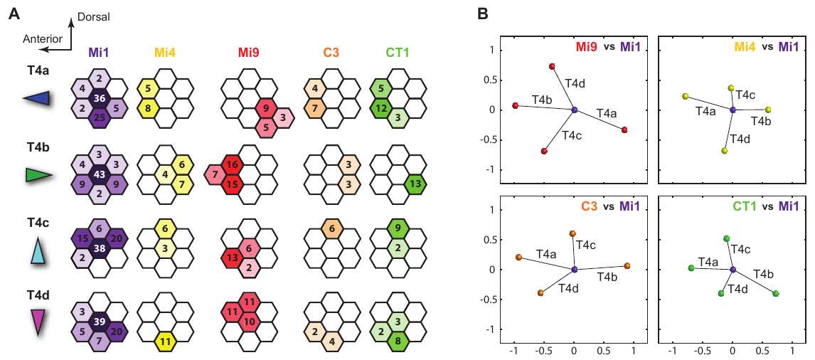
Enhancement and suppression occupy different positions
A T4 receptive field contains spatially different contributions to direction selectivity. Haag and colleagues mapped the nonlinear effects of stimulating the center together with neighboring ommatidia. Enhancement and suppression were concentrated on different sides of the center.
Takemura and colleagues reconstructed synaptic partners across neighboring medulla columns. Inputs from Mi1 and Tm3 were concentrated centrally, whereas other input types occupied displaced regions of the T4 dendrite. Spatial asymmetry is therefore present in both functional responses and anatomical connectivity.
The studies used different measurements and preparations. Correspondence between displaced inputs and nonlinear response regions constrains candidate mechanisms; it does not assign every physiological component to one identified synapse or directly measure transmission delays in the reconstructed neurons.
Haag et al. (2016), Fig. 3(d, e). Neighboring positions differ in their nonlinear influence.
Takemura et al. (2017), Fig. 4(A, B). T4 input distributions across neighboring columns.
Haag et al. (2016); Takemura et al. (2017)
22
Notes:
• Direction requires spatial asymmetry. If every input had the same location and time course, reversing a sequence would not necessarily produce a different combined response.
• The functional mapping measured changes in calcium, whereas the reconstruction counted and located synapses. Both found structured contributions around the center rather than an undifferentiated collection of inputs.
• The anatomical and functional results can be compared at the level of organization, but they cannot be treated as recordings from the same individual synapses. A candidate delayed input still requires physiological characterization, including its time course and sign.
References:
Haag J, Arenz A, Serbe E, Gabbiani F, Borst A (2016). Complementary mechanisms create direction selectivity in the fly. eLife 5:e17421. https://doi.org/10.7554/elife.17421
Takemura SY, Nern A, Chklovskii DB, Scheffer LK, Rubin GM, Meinertzhagen IA (2017). The comprehensive connectome of a neural substrate for 'ON' motion detection in Drosophila. eLife 6:e24394. https://doi.org/10.7554/elife.24394
Figure: Haag et al. (2016), Fig. 3(d, e). Neighboring positions differ in their nonlinear influence.
Figure source: https://doi.org/10.7554/elife.17421
Figure: Takemura et al. (2017), Fig. 4(A, B). T4 input distributions across neighboring columns.
Figure source: https://doi.org/10.7554/elife.24394

Slide 23
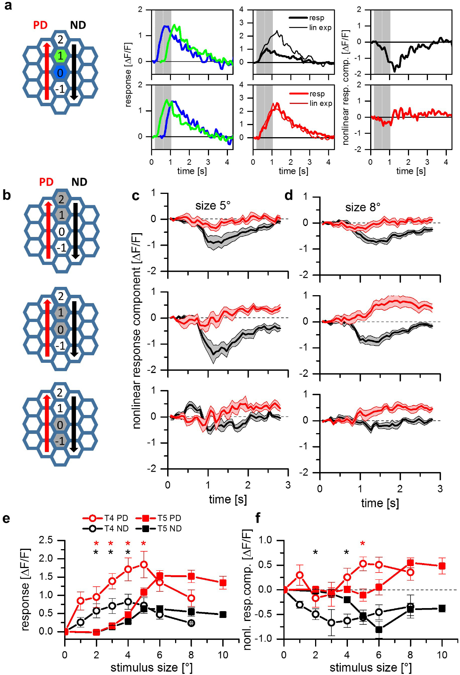
T5 combines the same complementary operations
T5 neurons preferentially respond to OFF-edge motion. Haag and colleagues stimulated neighboring visual columns with brightness decrements while imaging T5 terminal calcium, testing whether dark-edge motion required a different directional operation from T4.
A two-step sequence near the receptive-field center could produce both preferred-direction enhancement and null-direction suppression. Increasing the stimulus-spot diameter from 5° to 8° revealed preferred-direction enhancement alongside suppression.
The same classes of nonlinear operation can therefore occur in both ON and OFF pathways despite different input neurons and dendritic locations. A shared computation does not require identical receptive-field size, synaptic chemistry or temporal filtering in T4 and T5.
Haag et al. (2016), Fig. 1(b). T4/T5 anatomical compartments.
Haag et al. (2017), Fig. 2(a–f). OFF-cell sequences produce enhancement and suppression.
Haag et al. (2017); Shinomiya et al. (2019); Haag et al. (2016)
23
Notes:
• T5 receives its local inputs in the lobula rather than the T4 dendritic layer of the medulla. That anatomical difference makes the matching physiological operations an experimental result rather than an assumption based on identical circuitry.
• The authors used darkening stimuli and measured component flashes as controls for the sequence response. Both an excess in the preferred direction and a deficit in the null direction contributed to directional tuning.
• Spatial spacing affected the response because T5's effective receptive-field organization differed from that of T4. Similar enhancement and suppression categories do not mean that every parameter or every synaptic partner is the same in the two pathways.
References:
Haag J, Mishra A, Borst A (2017). A common directional tuning mechanism of Drosophila motion-sensing neurons in the ON and in the OFF pathway. eLife 6:e29044. https://doi.org/10.7554/elife.29044
Shinomiya K, Huang G, Lu Z, Parag T, Xu CS, Aniceto R, Ansari N, Cheatham N, Lauchie S, Neace E, Ogundeyi O, Ordish C, Peel D, Shinomiya A, Smith C, Takemura S, Talebi I, Rivlin PK, Nern A, Scheffer LK, Plaza SM, Meinertzhagen IA (2019). Comparisons between the ON- and OFF-edge motion pathways in the Drosophila brain. eLife 8:e40025. https://doi.org/10.7554/elife.40025
Haag J, Arenz A, Serbe E, Gabbiani F, Borst A (2016). Complementary mechanisms create direction selectivity in the fly. eLife 5:e17421. https://doi.org/10.7554/elife.17421
Figure: Haag et al. (2017), Fig. 2(a–f). OFF-cell sequences produce enhancement and suppression.
Figure source: https://doi.org/10.7554/elife.29044
Figure: Haag et al. (2016), Fig. 1(b). T4/T5 anatomical compartments.
Figure source: https://doi.org/10.7554/elife.17421

Slide 24
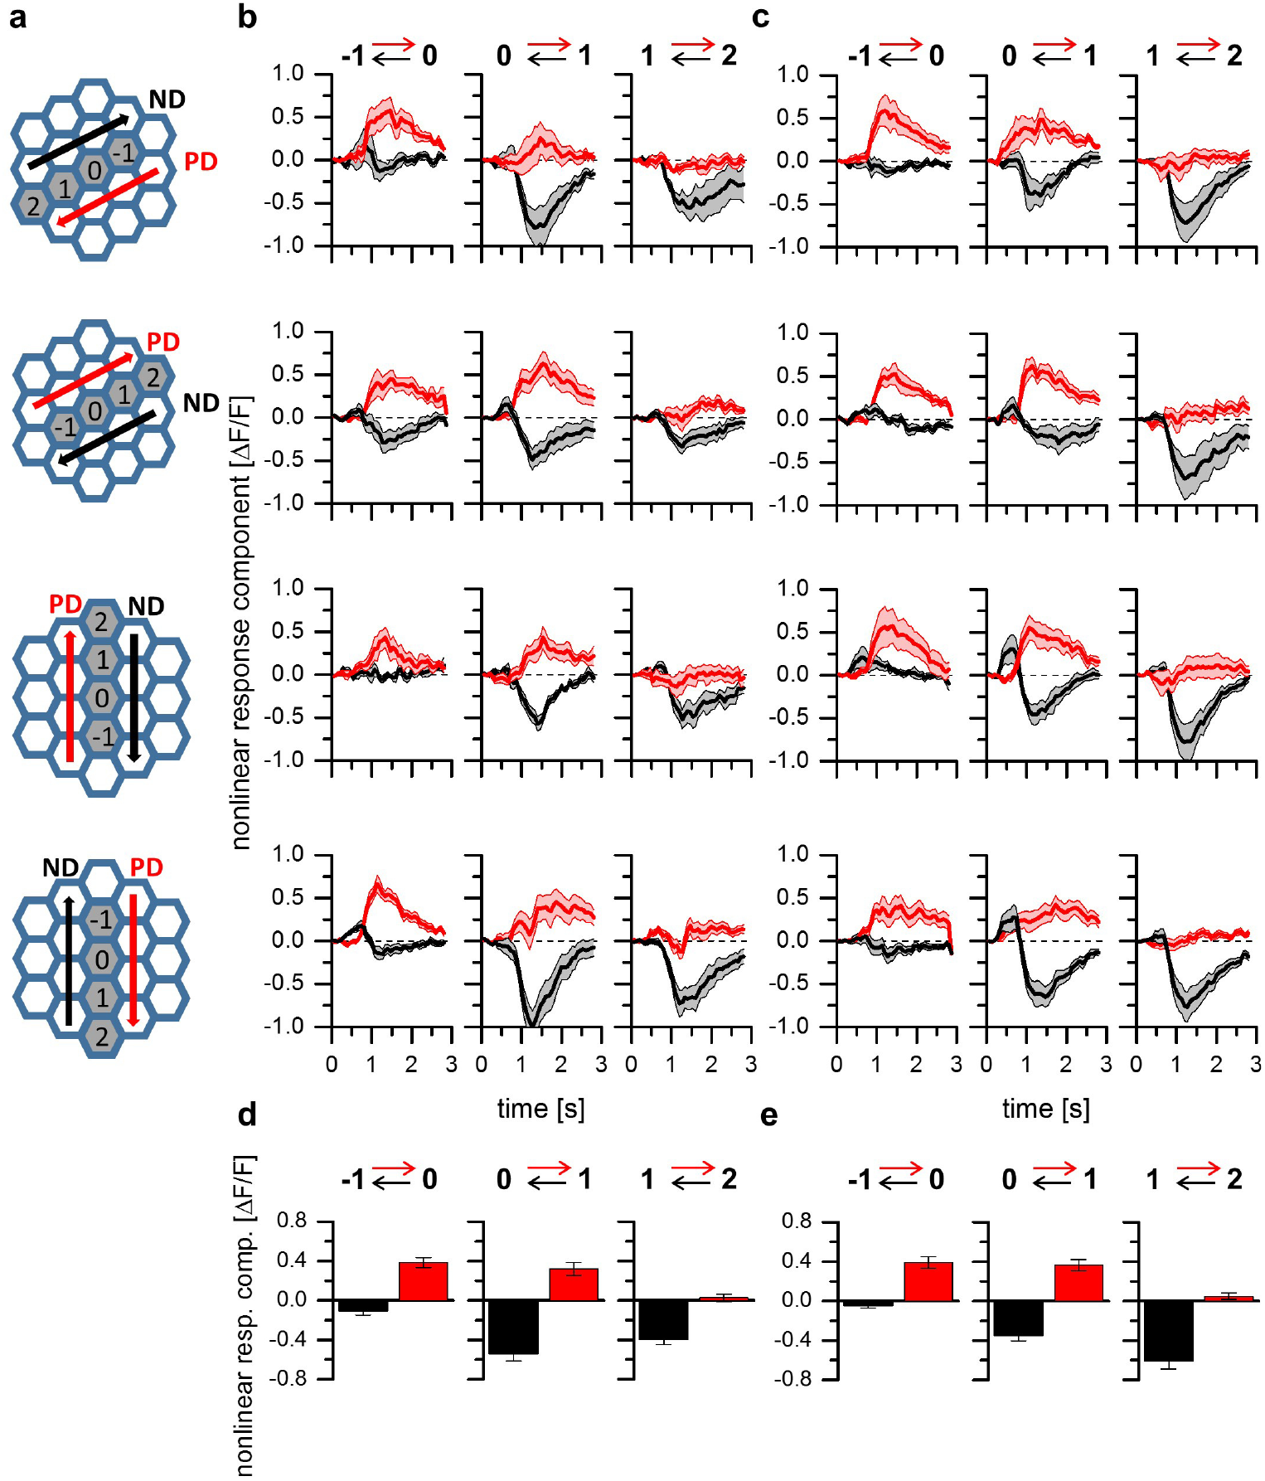
Complementary operations span all T4 and T5 subtypes
A mechanism measured in one directional subtype need not apply to all local motion neurons. Haag and colleagues compared T4 and T5 across all four lobula plate layers using two-step apparent-motion stimuli aligned with each subtype's preferred axis.
Preferred-direction enhancement occurred when the stimulus sequence traversed one side of the receptive field toward its center. Null-direction suppression occurred for the reverse sequence involving the complementary side. The comparison included both horizontal and vertical motion channels.
Enhancement and suppression therefore form a common functional organization across the tested ON and OFF subtypes. The subtype comparisons establish the generality of these operations under the experimental conditions; they do not establish that every input weight, channel complement or adaptation response is identical.
Haag et al. (2017), Fig. 4. Four direction layers.
Haag et al. (2017), Fig. 3. Nonlinear responses across four ON and OFF subtypes.
Haag et al. (2017)
24
Notes:
• The four directional subtypes provide a stronger test than repeating an experiment only in a horizontal neuron. The stimulus geometry must be rotated to match each cell's preferred and null directions.
• The same two categories of nonlinear response were found in the horizontal and vertical channels of both T4 and T5. Direction-specific anatomy is therefore compatible with a repeated computational organization.
• Generality of the operation is different from equality of all parameters. Different receptive-field sizes or temporal filters can coexist with a common arrangement of enhancement on one side and suppression on the other.
References:
Haag J, Mishra A, Borst A (2017). A common directional tuning mechanism of Drosophila motion-sensing neurons in the ON and in the OFF pathway. eLife 6:e29044. https://doi.org/10.7554/elife.29044
Figure: Haag et al. (2017), Fig. 3. Nonlinear responses across four ON and OFF subtypes.
Figure source: https://doi.org/10.7554/elife.29044
Figure: Haag et al. (2017), Fig. 4. Four direction layers.
Figure source: https://doi.org/10.7554/elife.29044

Slide 25
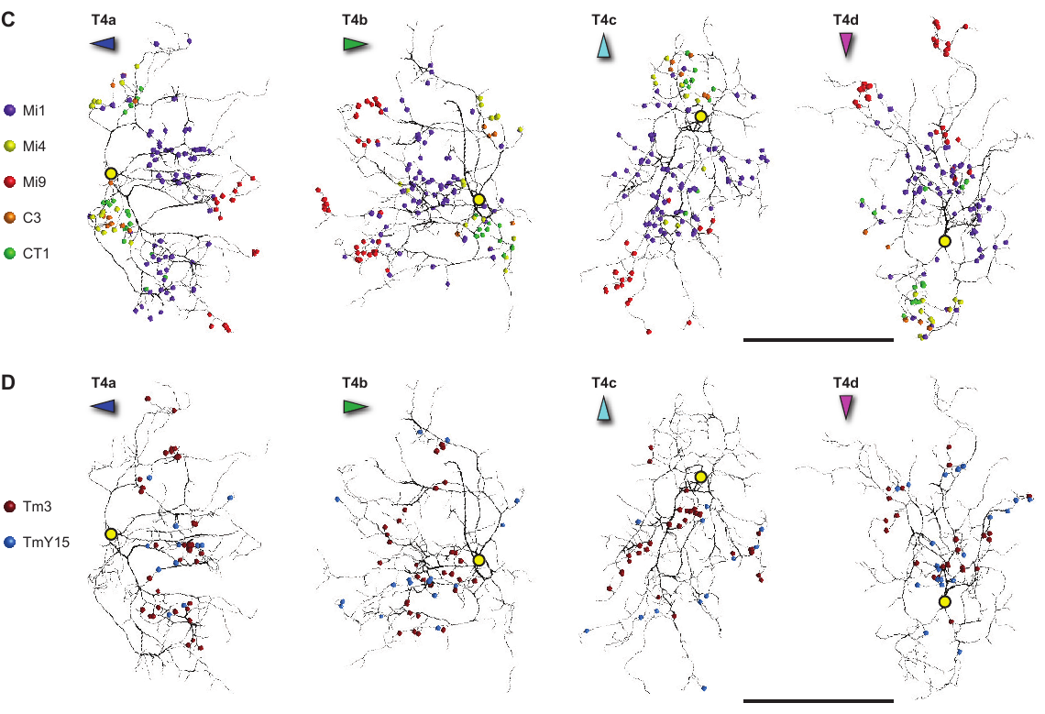
Synaptic partners occupy different parts of T4 dendrites
A connectome is a reconstruction of neurons and their synaptic connections. Takemura and colleagues traced inputs to four T4 subtypes in a focused-ion-beam scanning electron-microscopy volume, assigning contacts to identified presynaptic cell types.
Eight input classes accounted for more than 96% of the reconstructed T4 synapses. Their contacts were distributed unevenly: some concentrated along the dendritic shaft, some toward its tip, and others near the base. A dendrite therefore receives different combinations of signals at different locations.
Input position constrains which spatial signals can interact within T4. Synapse number measures anatomical connectivity, not physiological strength. The reconstruction does not directly establish receptor density, release probability or the response kinetics of an individual connection.
Takemura et al. (2017), Fig. 2(A–D). T4 inputs.
Takemura et al. (2017), Fig. 4(C, D). Synapse locations on four reconstructed T4 subtypes.
Takemura et al. (2017)
25
Notes:
• Electron microscopy identifies membrane contacts at a resolution sufficient to assign synapses to reconstructed neurons. The resulting connectome gives an input inventory rather than only a drawing of nearby processes.
• Most of the identified input was concentrated in eight classes, with distinct positions along the dendrite. That arrangement provides a physical substrate for unequal contributions from neighboring visual positions.
• More anatomical contacts need not mean proportionally greater functional current. The physiological effect also depends on release, receptor properties and the neuron's electrical state, none of which is measured directly by counting synapses in a fixed specimen.
References:
Takemura SY, Nern A, Chklovskii DB, Scheffer LK, Rubin GM, Meinertzhagen IA (2017). The comprehensive connectome of a neural substrate for 'ON' motion detection in Drosophila. eLife 6:e24394. https://doi.org/10.7554/elife.24394
Figure: Takemura et al. (2017), Fig. 4(C, D). Synapse locations on four reconstructed T4 subtypes.
Figure source: https://doi.org/10.7554/elife.24394
Figure: Takemura et al. (2017), Fig. 2(A–D). T4 inputs.
Figure source: https://doi.org/10.7554/elife.24394

Slide 26
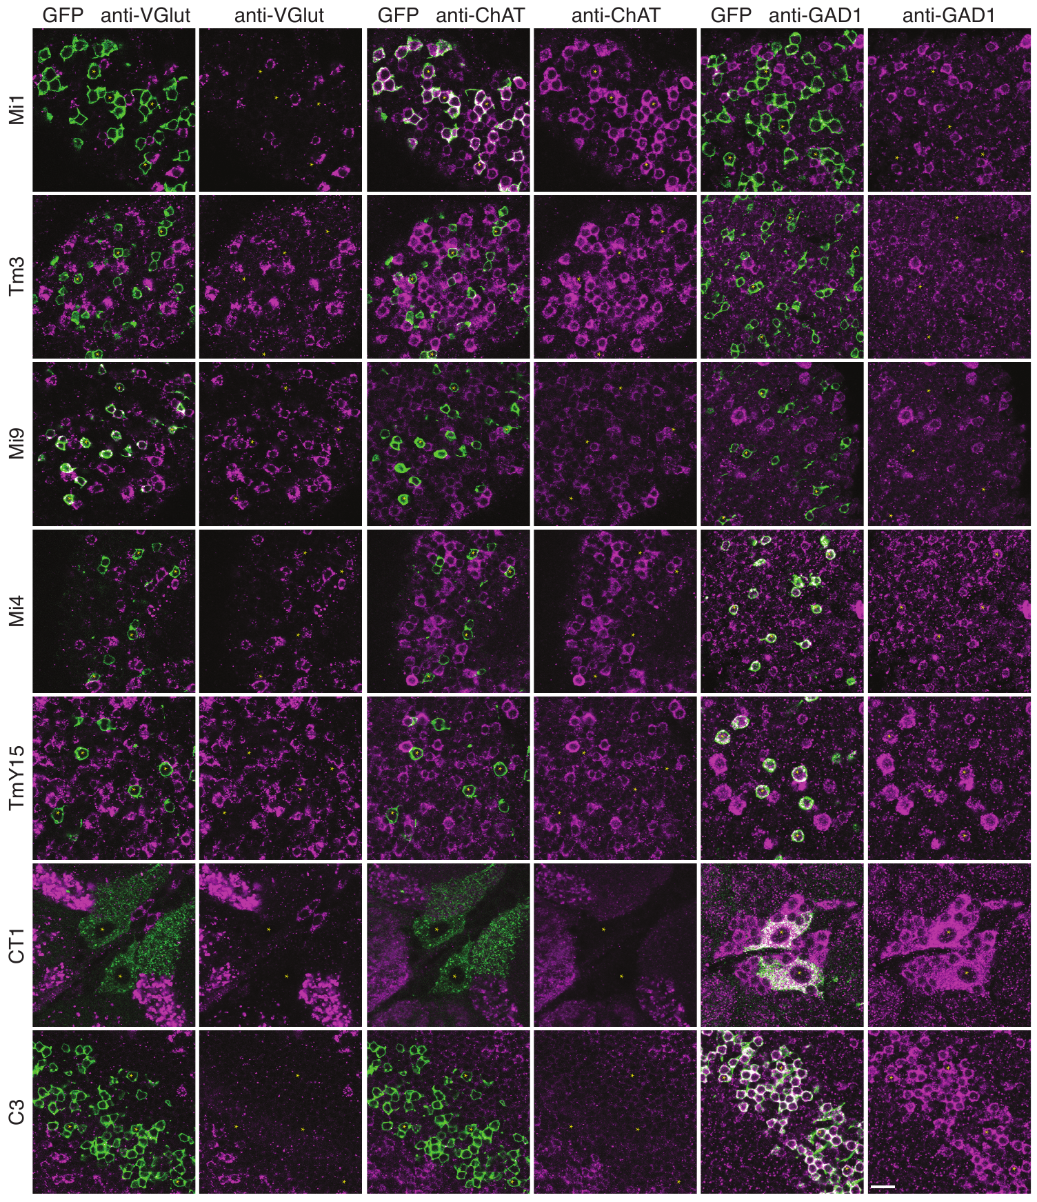
Central T4 inputs include Mi1 and Tm3
Mi1 and Tm3 are medulla interneurons relaying visual input to T4. Takemura and colleagues found that these two cell types supplied the largest portions of reconstructed T4 input, approximately 35% and 16% of its synaptic contacts, respectively.
Their synapses overlapped substantially along the dendritic shaft. Antibody labeling detected choline acetyltransferase, the enzyme that synthesizes acetylcholine, in Mi1 and Tm3. The combined anatomical and chemical evidence supports major cholinergic inputs to T4.
The expanded reconstruction did not reproduce a consistent Mi1–Tm3 spatial offset proposed from an earlier volume. Strong central input alone therefore does not identify the complete Reichardt detector. Additional displaced inputs and their functional time courses must be considered when interpreting directional computation.
Takemura et al. (2017), Fig. 4(C, D). T4 synapses.
Takemura et al. (2017), Fig. 5. Transmitter-marker staining of T4 inputs.
Takemura et al. (2017)
26
Notes:
• Mi1 and Tm3 are major input pathways, but major does not mean sufficient by themselves. They account for large fractions of the reconstructed contacts and overlap over much of the same dendritic region.
• Choline acetyltransferase is a marker of the ability to synthesize acetylcholine. Detecting it in labeled neurons supplies chemical evidence that complements the connection tracing, rather than measuring transmitter release at a particular synapse.
• The newer reconstruction could not reproduce the earlier proposed consistent displacement between Mi1 and Tm3. This limits a simple two-input explanation based solely on those anatomical centers and leaves other input channels as necessary candidates for the directional asymmetry.
References:
Takemura SY, Nern A, Chklovskii DB, Scheffer LK, Rubin GM, Meinertzhagen IA (2017). The comprehensive connectome of a neural substrate for 'ON' motion detection in Drosophila. eLife 6:e24394. https://doi.org/10.7554/elife.24394
Figure: Takemura et al. (2017), Fig. 5. Transmitter-marker staining of T4 inputs.
Figure source: https://doi.org/10.7554/elife.24394
Figure: Takemura et al. (2017), Fig. 4(C, D). T4 synapses.
Figure source: https://doi.org/10.7554/elife.24394

Slide 27
T4 also receives inhibitory and glutamatergic inputs
Mi4 and Mi9 contribute spatially displaced inputs to T4. Takemura and colleagues combined synapse reconstruction with immunolabeling, staining identified cell bodies for acetylcholine, glutamate and GABA-related markers rather than assigning chemistry from morphology alone.
Mi4 labeled for GAD1, glutamic acid decarboxylase, which synthesizes the neurotransmitter GABA. Mi9 labeled for VGlut, a transporter that packages glutamate into synaptic vesicles. These markers support GABAergic and glutamatergic input identities, respectively.
Glutamate is not necessarily excitatory in the fly. T4/T5 transcriptomics detected GluClα, a glutamate-gated chloride channel associated with hyperpolarizing responses. Input chemistry, receptor identity and membrane conditions jointly determine response sign; a transmitter marker alone does not measure the current at a T4 synapse.
Takemura et al. (2017), Fig. 2(A–D). T4 inputs.
Takemura et al. (2017), Fig. 5. Transmitter markers in identified T4 input neurons.
Takemura et al. (2017); Pankova & Borst (2016)
27
Notes:
• GABA and glutamate are chemical transmitters, but a transmitter's effect depends on the receptor activated in the receiving neuron. The marker stains identify synthetic or packaging machinery in particular input cells.
• Mi4 carries the GABA-synthesis marker and Mi9 the vesicular glutamate marker. Their displaced synaptic locations make them candidates for spatially asymmetric contributions, while the staining distinguishes their chemistry from the central cholinergic inputs.
• GluClα provides a mechanism through which glutamate can activate a chloride conductance rather than a depolarizing cation conductance. Its transcript in the pooled T4/T5 population supports a possible inhibitory response, but does not establish receptor placement at every reconstructed Mi9 contact.
References:
Takemura SY, Nern A, Chklovskii DB, Scheffer LK, Rubin GM, Meinertzhagen IA (2017). The comprehensive connectome of a neural substrate for 'ON' motion detection in Drosophila. eLife 6:e24394. https://doi.org/10.7554/elife.24394
Pankova K, Borst A (2016). RNA-Seq Transcriptome Analysis of Direction-Selective T4/T5 Neurons in Drosophila. PLoS ONE 11:e0163986. https://doi.org/10.1371/journal.pone.0163986
Figure: Takemura et al. (2017), Fig. 5. Transmitter markers in identified T4 input neurons.
Figure source: https://doi.org/10.7554/elife.24394
Figure: Takemura et al. (2017), Fig. 2(A–D). T4 inputs.
Figure source: https://doi.org/10.7554/elife.24394

Slide 28
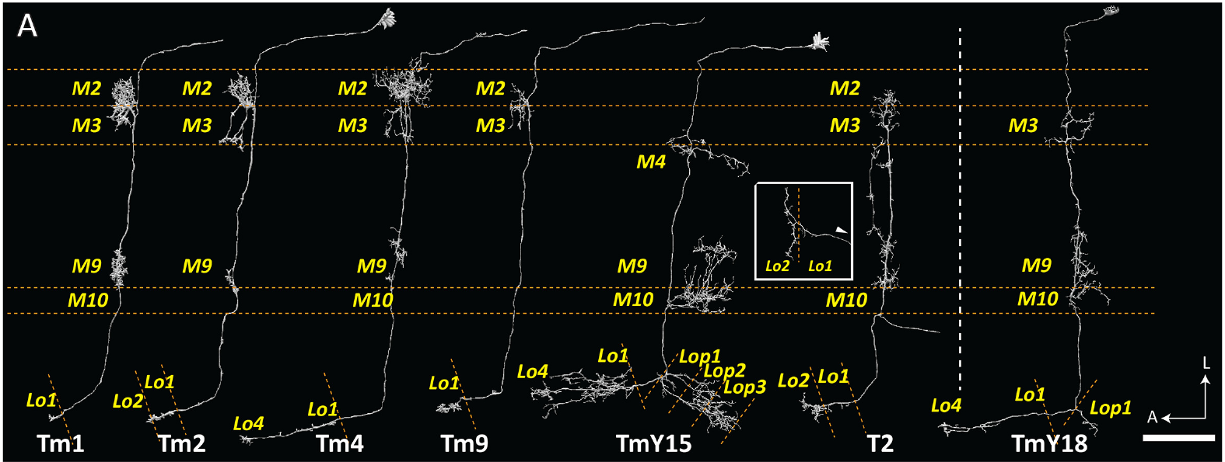
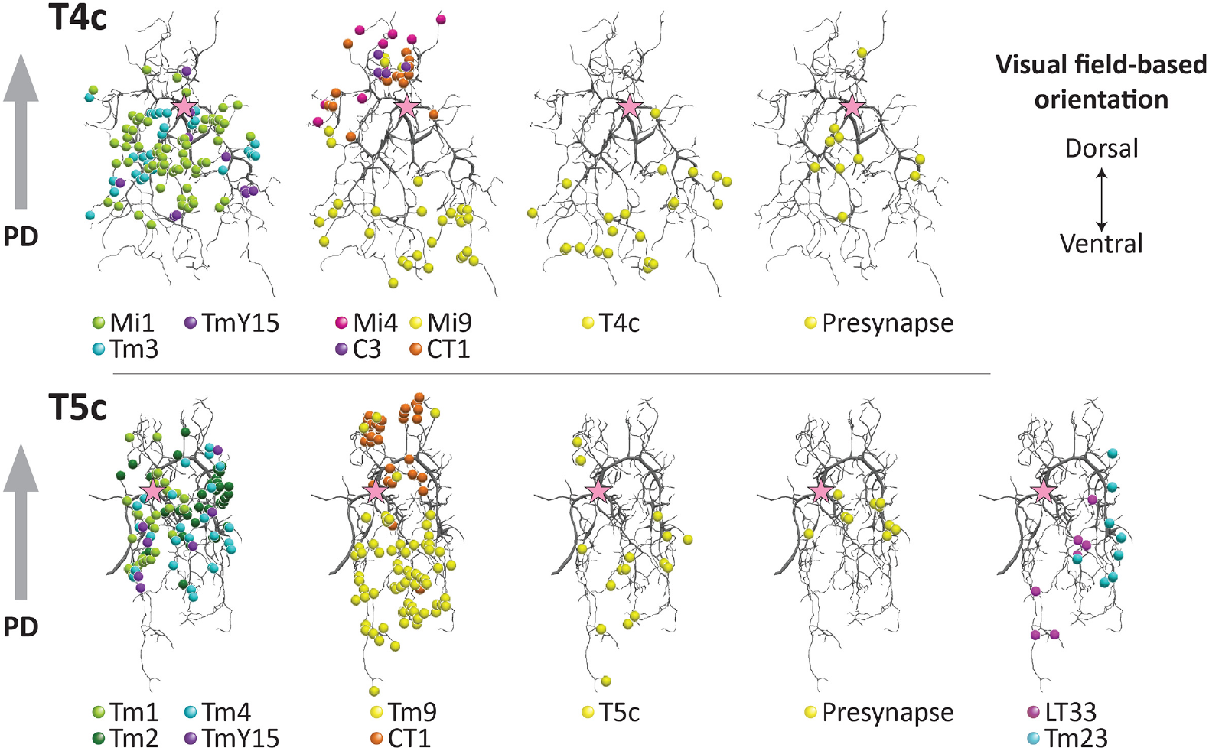
OFF-pathway inputs converge on T5 dendrites
The transmedullary neurons Tm1, Tm2, Tm4 and Tm9 carry signals from the medulla to the lobula. Shinomiya and colleagues reconstructed their connections onto T5 dendrites in Lo1, linking the OFF pathway's relay cells to local motion computation.
Input locations were organized across each T5 dendrite. Tm1, Tm2 and Tm4 contributed centrally, while Tm9 supplied contacts displaced toward the dendritic tip. Other partners, including CT1, contributed near different dendritic regions.
These spatial relationships resemble the differentiated input zones of T4 while using a different set of relay neurons. Electron microscopy establishes connection geometry. The temporal ordering of those input signals and the nonlinear interaction producing an OFF-motion response require separate functional evidence.
Shinomiya et al. (2019), Fig. 3(A). Reconstructed OFF-pathway input neurons.
Shinomiya et al. (2019), Fig. 4. Synaptic distributions on T4 and T5 dendrites.
Shinomiya et al. (2019)
28
Notes:
• Transmedullary describes the route through the optic neuropils: these neurons relay medulla signals into the lobula. Their repeated columnar positions preserve a relationship to the local visual field.
• The T5 dendrite is not contacted uniformly by all relay types. Central input classes and displaced input classes can provide distinct information to different parts of the same receiving neuron.
• Similar geometry in the ON and OFF circuits does not make their relay cells interchangeable. The anatomy establishes where information can enter, while a recording or causal perturbation is needed to determine the timing and influence of each input.
References:
Shinomiya K, Huang G, Lu Z, Parag T, Xu CS, Aniceto R, Ansari N, Cheatham N, Lauchie S, Neace E, Ogundeyi O, Ordish C, Peel D, Shinomiya A, Smith C, Takemura S, Talebi I, Rivlin PK, Nern A, Scheffer LK, Plaza SM, Meinertzhagen IA (2019). Comparisons between the ON- and OFF-edge motion pathways in the Drosophila brain. eLife 8:e40025. https://doi.org/10.7554/elife.40025
Figure: Shinomiya et al. (2019), Fig. 3(A). Reconstructed OFF-pathway input neurons.
Figure source: https://doi.org/10.7554/elife.40025
Figure: Shinomiya et al. (2019), Fig. 4. Synaptic distributions on T4 and T5 dendrites.
Figure source: https://doi.org/10.7554/elife.40025

Slide 29
ON and OFF circuits share a spatial organization
A presynaptic neuron supplies a synaptic output, whereas the postsynaptic neuron receives it. Shinomiya and colleagues mapped input and output contacts along reconstructed T4 and T5 dendrites, distinguishing their partners and the direction of transmission.
Both pathways combined central contacts, displaced tip contacts and base-associated contacts. T4 received inputs including Mi1, Tm3, Mi9 and inhibitory partners; T5 combined Tm1, Tm2, Tm4, Tm9 and CT1. Four directional subtypes rotated the effective arrangement relative to visual space.
The shared pattern is a repeated organizational principle, not identical wiring. Additional partners and local outputs differ between the pathways. A circuit comparison therefore supports common computational constraints while preserving pathway-specific opportunities for timing, feedback and contrast dependence.
Shinomiya et al. (2019), Fig. 4. ON and OFF synapses occupy comparable dendritic zones.
Shinomiya et al. (2019)
29
Notes:
• Tracing a contact requires identifying which neuron is presynaptic and which is postsynaptic. A dendrite can also provide local output, so proximity alone does not determine the direction of information flow.
• The investigators found comparable distributions of central and displaced input in the two pathways, using different named partners. Rotating the arrangement across directional subtypes allows related local computations to support different preferred directions.
• The reconstruction also includes connections that differ between T4 and T5. Those differences can influence the circuit without invalidating the shared organization, and they prevent the two pathways from being reduced to exact copies distinguished only by bright versus dark stimuli.
References:
Shinomiya K, Huang G, Lu Z, Parag T, Xu CS, Aniceto R, Ansari N, Cheatham N, Lauchie S, Neace E, Ogundeyi O, Ordish C, Peel D, Shinomiya A, Smith C, Takemura S, Talebi I, Rivlin PK, Nern A, Scheffer LK, Plaza SM, Meinertzhagen IA (2019). Comparisons between the ON- and OFF-edge motion pathways in the Drosophila brain. eLife 8:e40025. https://doi.org/10.7554/elife.40025
Figure: Shinomiya et al. (2019), Fig. 4. ON and OFF synapses occupy comparable dendritic zones.
Figure source: https://doi.org/10.7554/elife.40025

Slide 30
Connectomes constrain circuits without measuring time
A spatially ordered input network can support delayed enhancement and suppression, but an anatomical contact does not specify a temporal filter. Synaptic counts and dendritic geometry constrain candidate motion computations without recording the activity of their input channels.
Takemura and Shinomiya reconstructed multiple relay routes reaching T4 or T5, including paths with different numbers of intervening synapses. Their published circuit accounts distinguish known connectivity from proposed excitatory, inhibitory and timing contributions.
A longer anatomical route need not have a uniquely determined delay, and a large contact count need not imply a fixed response weight. Physiology, receptor measurements and selective perturbation must establish those functional properties. The Reichardt algorithm and connectome can be consistent without identifying a single two-neuron implementation.
Shinomiya et al. (2019), Fig. 6. Published circuit account distinguishes measured and proposed links.
Takemura et al. (2017); Shinomiya et al. (2019)
30
Notes:
• Anatomy places restrictions on possible computations because a receiving neuron can interact only with signals that reach it. It does not supply the full time course of those signals.
• Different routes can contain different numbers of intervening neurons, but their effective timing also depends on membrane and synaptic dynamics. Counting steps is therefore a hypothesis about delay rather than a delay measurement.
• The published circuit account combines established connections with proposed functional roles. Those categories must remain separate: a reconstructed input is evidence of connectivity, whereas its contribution to enhancement or suppression needs a physiological or causal test.
References:
Takemura SY, Nern A, Chklovskii DB, Scheffer LK, Rubin GM, Meinertzhagen IA (2017). The comprehensive connectome of a neural substrate for 'ON' motion detection in Drosophila. eLife 6:e24394. https://doi.org/10.7554/elife.24394
Shinomiya K, Huang G, Lu Z, Parag T, Xu CS, Aniceto R, Ansari N, Cheatham N, Lauchie S, Neace E, Ogundeyi O, Ordish C, Peel D, Shinomiya A, Smith C, Takemura S, Talebi I, Rivlin PK, Nern A, Scheffer LK, Plaza SM, Meinertzhagen IA (2019). Comparisons between the ON- and OFF-edge motion pathways in the Drosophila brain. eLife 8:e40025. https://doi.org/10.7554/elife.40025
Figure: Shinomiya et al. (2019), Fig. 6. Published circuit account distinguishes measured and proposed links.
Figure source: https://doi.org/10.7554/elife.40025

Slide 31
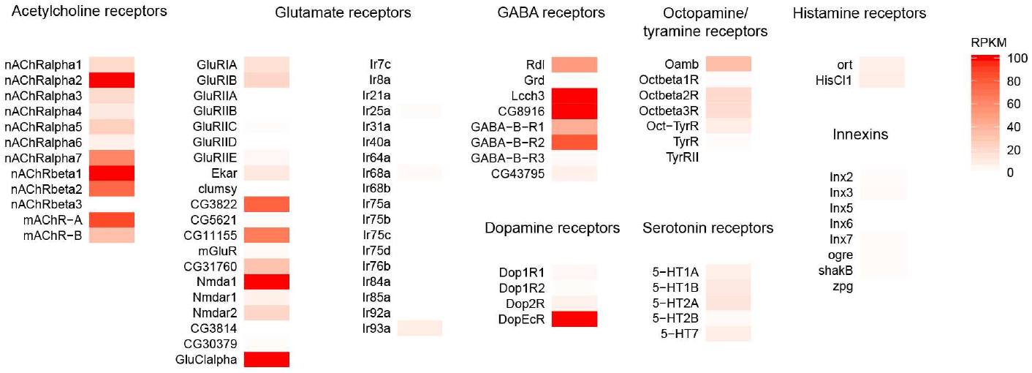
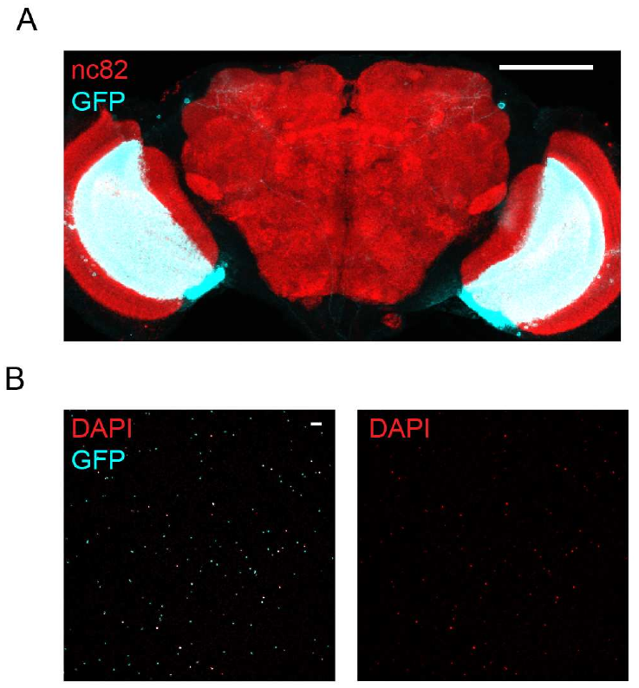
T4 and T5 express multiple receptor classes
A receptor is a protein through which a neuron detects a signal such as a neurotransmitter. An ionotropic receptor directly controls an ion channel; a metabotropic receptor acts through intracellular signaling. Either class can alter a neuron's integration of input.
Pankova and Borst isolated genetically labeled T4/T5 nuclei and used RNA sequencing to measure expressed transcripts. They detected nicotinic and muscarinic acetylcholine receptor transcripts, GABA receptor transcripts and the glutamate-gated chloride channel GluClα.
The published heat map reports RPKM, reads per kilobase of transcript per million mapped reads, on a 0–100 color scale. The assay pooled T4 and T5 and measured RNA. It did not establish protein abundance, receptor location or functional responses separately in each cell class.
Pankova & Borst (2016), Fig. 3. Receptor transcripts quantified on the original expression scale.
Pankova & Borst (2016), Fig. 2(A, B). Labeled T4/T5 neurons and isolated nuclei.
Pankova & Borst (2016)
31
Notes:
• Nicotinic acetylcholine receptors are ionotropic, whereas muscarinic receptors signal through intracellular pathways. The expression of both categories permits several possible relationships between acetylcholine input and the receiving neuron's activity.
• Genetically labeled nuclei enriched the sample for T4 and T5. Sequencing then measured transcripts for receptor subunits rather than testing synaptic responses directly. The original color scale is a normalized expression measure, not a current amplitude.
• Pooling the two cell classes limits the interpretation. An expressed transcript may occur in one class, in both or at different levels, and an RNA result does not locate the resulting protein on a particular dendritic compartment.
References:
Pankova K, Borst A (2016). RNA-Seq Transcriptome Analysis of Direction-Selective T4/T5 Neurons in Drosophila. PLoS ONE 11:e0163986. https://doi.org/10.1371/journal.pone.0163986
Figure: Pankova & Borst (2016), Fig. 3. Receptor transcripts quantified on the original expression scale.
Figure source: https://doi.org/10.1371/journal.pone.0163986
Figure: Pankova & Borst (2016), Fig. 2(A, B). Labeled T4/T5 neurons and isolated nuclei.
Figure source: https://doi.org/10.1371/journal.pone.0163986

Slide 32
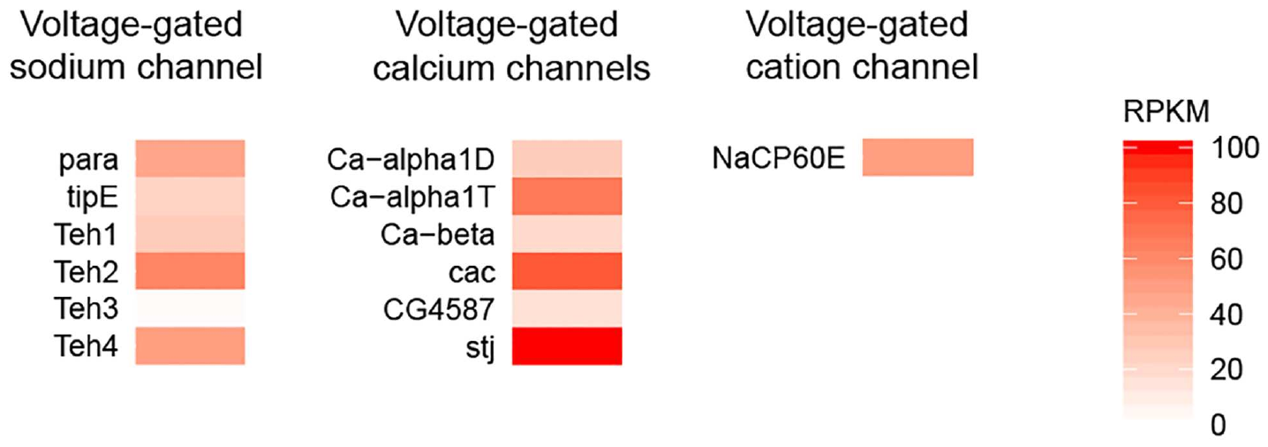
Sodium and calcium channels shape membrane signaling
A voltage-gated ion channel changes its opening probability with membrane potential, the electrical potential across the cell membrane. Such channels can transform synaptic input into different voltage and calcium responses instead of transmitting a passive copy of the input.
Pankova and Borst detected the sodium-channel gene para, four of its five identified auxiliary subunits, and transcripts for the identified voltage-gated calcium-channel subunits. They also detected NaCP60E, a cation channel permeable to sodium and calcium.
Channel expression provides molecular candidates for active processing and calcium entry in T4/T5. The transcriptome does not establish that these neurons fire sodium action potentials, identify the channels carrying a recorded calcium signal, or prove that one channel implements the detector's effective temporal delay.
Pankova & Borst (2016), Fig. 4. Voltage-gated channel transcripts in pooled T4/T5 neurons.
Pankova & Borst (2016), Fig. 2(A, B). Labeled T4/T5 neurons and isolated nuclei.
Pankova & Borst (2016)
32
Notes:
• Voltage-gated means that the membrane potential affects channel opening. Sodium and calcium conductances can therefore change the relationship between input current, membrane voltage and intracellular calcium.
• The sequencing assay detected para together with several modulatory subunits and a range of calcium-channel transcripts. An auxiliary subunit can influence the behavior of a channel without itself defining the pore carrying the ions.
• The presence of the molecular components is evidence of capacity, not a recording of their use. Establishing action potentials or a particular delay mechanism requires electrical measurements and perturbation of the relevant channel, rather than an inference from RNA expression alone.
References:
Pankova K, Borst A (2016). RNA-Seq Transcriptome Analysis of Direction-Selective T4/T5 Neurons in Drosophila. PLoS ONE 11:e0163986. https://doi.org/10.1371/journal.pone.0163986
Figure: Pankova & Borst (2016), Fig. 4. Voltage-gated channel transcripts in pooled T4/T5 neurons.
Figure source: https://doi.org/10.1371/journal.pone.0163986
Figure: Pankova & Borst (2016), Fig. 2(A, B). Labeled T4/T5 neurons and isolated nuclei.
Figure source: https://doi.org/10.1371/journal.pone.0163986

Slide 33
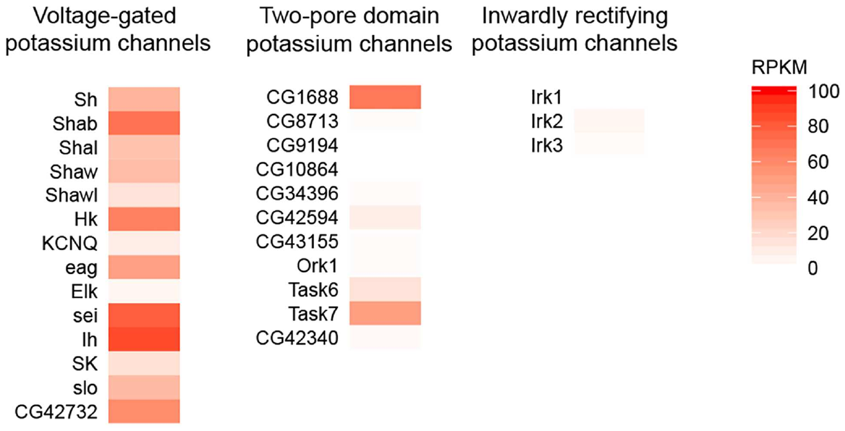
Potassium channels can regulate temporal integration
Potassium channels conduct potassium ions and can influence how membrane voltage evolves after excitation. Temporal integration is the combination of inputs over time; channel kinetics can alter the interval over which previous input affects a neuron's response.
Pankova and Borst detected transcripts for multiple voltage-gated and two-pore-domain potassium channels in pooled T4/T5 nuclei. Shaker, Shal and SK were among the strongly expressed candidates; inwardly rectifying potassium-channel transcripts were not detected in their assay.
The authors proposed that active membrane conductances could contribute to delays and nonlinear interactions within motion detectors. This is a mechanistic possibility supported by molecular capacity, not a demonstration that a named potassium channel generates preferred-direction enhancement or null-direction suppression. Channel-specific causal experiments are required.
Pankova & Borst (2016), Fig. 5. Potassium-channel transcripts on the original RPKM scale.
Pankova & Borst (2016), Fig. 2(A, B). Labeled T4/T5 neurons and isolated nuclei.
Pankova & Borst (2016)
33
Notes:
• Potassium conductances can change membrane responses after excitation and therefore influence how two inputs arriving at different times combine. Their effect depends on when the channels activate and on the membrane conditions.
• The transcriptome included several potassium-channel families. The different categories have different gating properties, so the expression list offers multiple candidate mechanisms rather than one uniquely specified delay element.
• The paper uses the expression results to propose active dendritic processing. It does not selectively remove a channel and measure the resulting motion computation, so assigning the observed enhancement or suppression to Shaker, Shal or SK would go beyond the experiment.
References:
Pankova K, Borst A (2016). RNA-Seq Transcriptome Analysis of Direction-Selective T4/T5 Neurons in Drosophila. PLoS ONE 11:e0163986. https://doi.org/10.1371/journal.pone.0163986
Figure: Pankova & Borst (2016), Fig. 5. Potassium-channel transcripts on the original RPKM scale.
Figure source: https://doi.org/10.1371/journal.pone.0163986
Figure: Pankova & Borst (2016), Fig. 2(A, B). Labeled T4/T5 neurons and isolated nuclei.
Figure source: https://doi.org/10.1371/journal.pone.0163986

Slide 34
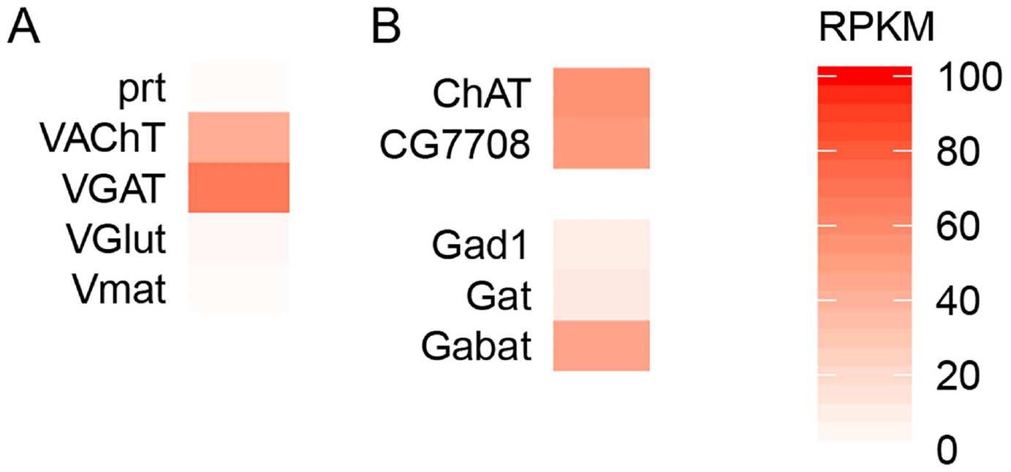
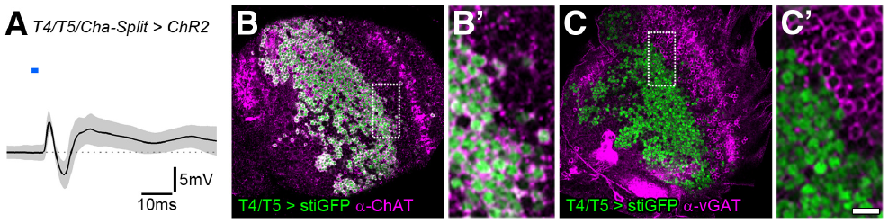
T4 and T5 have cholinergic transmitter machinery
A neuron's transmitter phenotype describes the chemical signaling machinery it uses. Choline acetyltransferase synthesizes acetylcholine, and the vesicular acetylcholine transporter packages it for synaptic release. Pankova and Borst detected transcripts for both in T4/T5.
Mauss and colleagues combined cell labeling with optogenetic stimulation and recordings from downstream lobula plate neurons. T4/T5 terminals labeled with the acetylcholine-synthesis marker, and selective activation of cholinergic T4/T5 produced rapid excitation followed by inhibition.
The transcriptome also detected vesicular GABA-transporter expression, creating a molecular question about additional signaling. Expression alone does not establish functional GABA release. The physiological and pharmacological results support a primarily cholinergic output with an indirect inhibitory route rather than direct inhibitory transmission from every T4/T5 terminal.
Pankova & Borst (2016), Fig. 6. Transcripts for transmitter packaging and synthesis.
Mauss et al. (2014), Fig. 3. Physiology and transmitter-marker staining in T4/T5.
Pankova & Borst (2016); Mauss et al. (2014)
34
Notes:
• Transmitter identity can be assessed at several levels: RNA for synthetic and packaging proteins, antibody labeling of those proteins, and the response to selective stimulation plus receptor antagonists. Those assays should not be treated as interchangeable.
• The acetylcholine machinery appears in both transcriptomic and labeling evidence, and activating the cholinergic T4/T5 population drives a downstream response. This combination is stronger than assigning transmitter identity from a receptor transcript in the receiving cell.
• The GABA-transporter result raises a possibility but does not establish cotransmission. Direct inhibition would require evidence of inhibitory release from T4/T5 onto the recorded neuron, whereas the stimulation and pharmacology support an intervening inhibitory pathway.
References:
Pankova K, Borst A (2016). RNA-Seq Transcriptome Analysis of Direction-Selective T4/T5 Neurons in Drosophila. PLoS ONE 11:e0163986. https://doi.org/10.1371/journal.pone.0163986
Mauss AS, Meier M, Serbe E, Borst A (2014). Optogenetic and pharmacologic dissection of feedforward inhibition in Drosophila motion vision. Journal of Neuroscience 34:2254-2263. https://doi.org/10.1523/jneurosci.3938-13.2014
Figure: Pankova & Borst (2016), Fig. 6. Transcripts for transmitter packaging and synthesis.
Figure source: https://doi.org/10.1371/journal.pone.0163986
Figure: Mauss et al. (2014), Fig. 3. Physiology and transmitter-marker staining in T4/T5.
Figure source: https://doi.org/10.1523/jneurosci.3938-13.2014

Slide 35
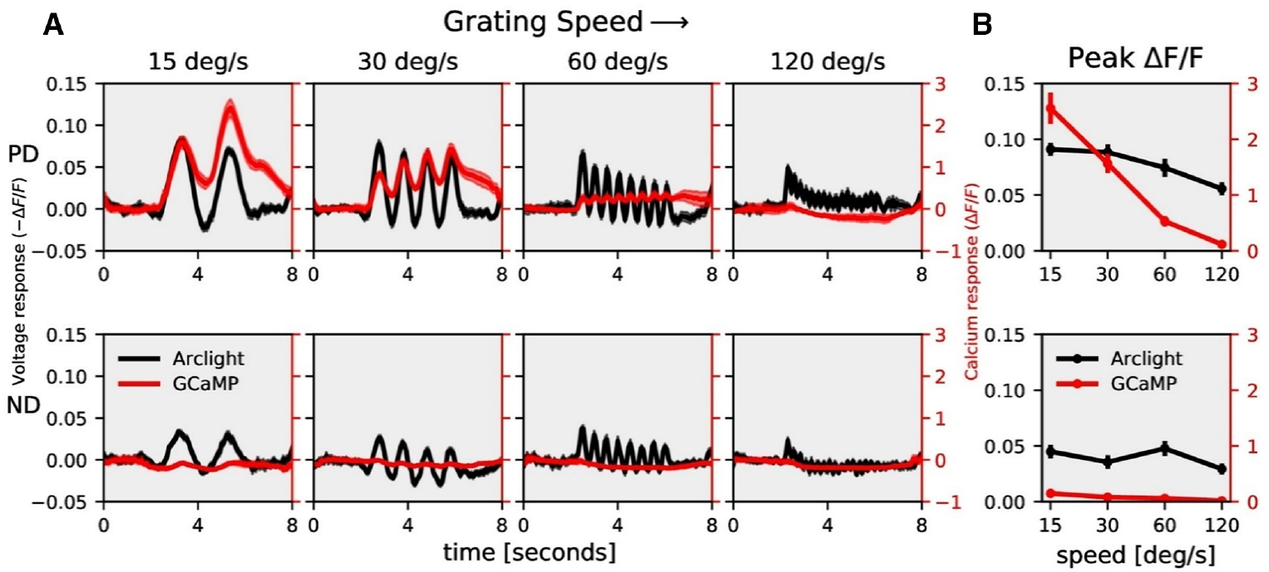
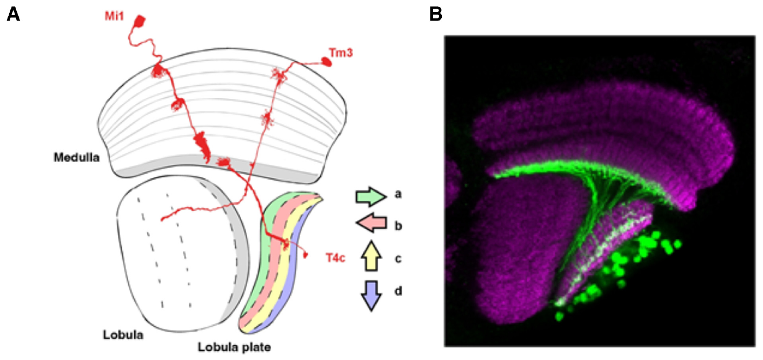
Calcium can sharpen voltage-based direction selectivity
ArcLight is a fluorescent voltage indicator; GCaMP6f reports intracellular calcium. Mishra and colleagues expressed them in T4c neurons, whose preferred direction is upward, and compared dendritic responses to the same visual stimulus set.
Gratings had wavelength 30° and moved at 15, 30, 60 or 120°/s. Voltage responses retained substantial null-direction activity, whereas calcium responses were more strongly biased toward the preferred direction. The difference was particularly pronounced at slower speeds.
The voltage-to-calcium transformation therefore contributes to measured direction selectivity rather than simply copying membrane voltage. Calcium-based estimates of the circuit's selectivity can exceed voltage-based estimates. The comparison used different labeled preparations for the two indicators, so it does not amount to simultaneous voltage and calcium recording from one neuron.
Mishra et al. (2023), Fig. 1(A, B). T4c anatomy.
Mishra et al. (2023), Fig. 2(A, B). ArcLight and GCaMP motion responses and their speed dependence.
Mishra et al. (2023)
35
Notes:
• ArcLight fluorescence decreases during depolarization, so the authors accounted for the indicator's sign when comparing it with calcium fluorescence. Both probes were targeted to the same T4 subtype and dendritic layer.
• The investigators used identical stimulus parameters across the indicator experiments. Preferred-direction voltage and calcium responses were strong, but the null-direction voltage response was much more apparent than the corresponding calcium response.
• The different selectivity follows from the transformation between electrical activity and calcium entry or handling. It also limits the inference from earlier calcium imaging: a highly selective fluorescent response does not mean that every underlying voltage input is equally selective.
References:
Mishra A, Serbe-Kamp E, Borst A, Haag J (2023). Voltage to Calcium Transformation Enhances Direction Selectivity in Drosophila T4 Neurons. Journal of Neuroscience 43:2497-2514. https://doi.org/10.1523/jneurosci.2297-22.2023
Figure: Mishra et al. (2023), Fig. 2(A, B). ArcLight and GCaMP motion responses and their speed dependence.
Figure source: https://doi.org/10.1523/jneurosci.2297-22.2023
Figure: Mishra et al. (2023), Fig. 1(A, B). T4c anatomy.
Figure source: https://doi.org/10.1523/jneurosci.2297-22.2023

Slide 36
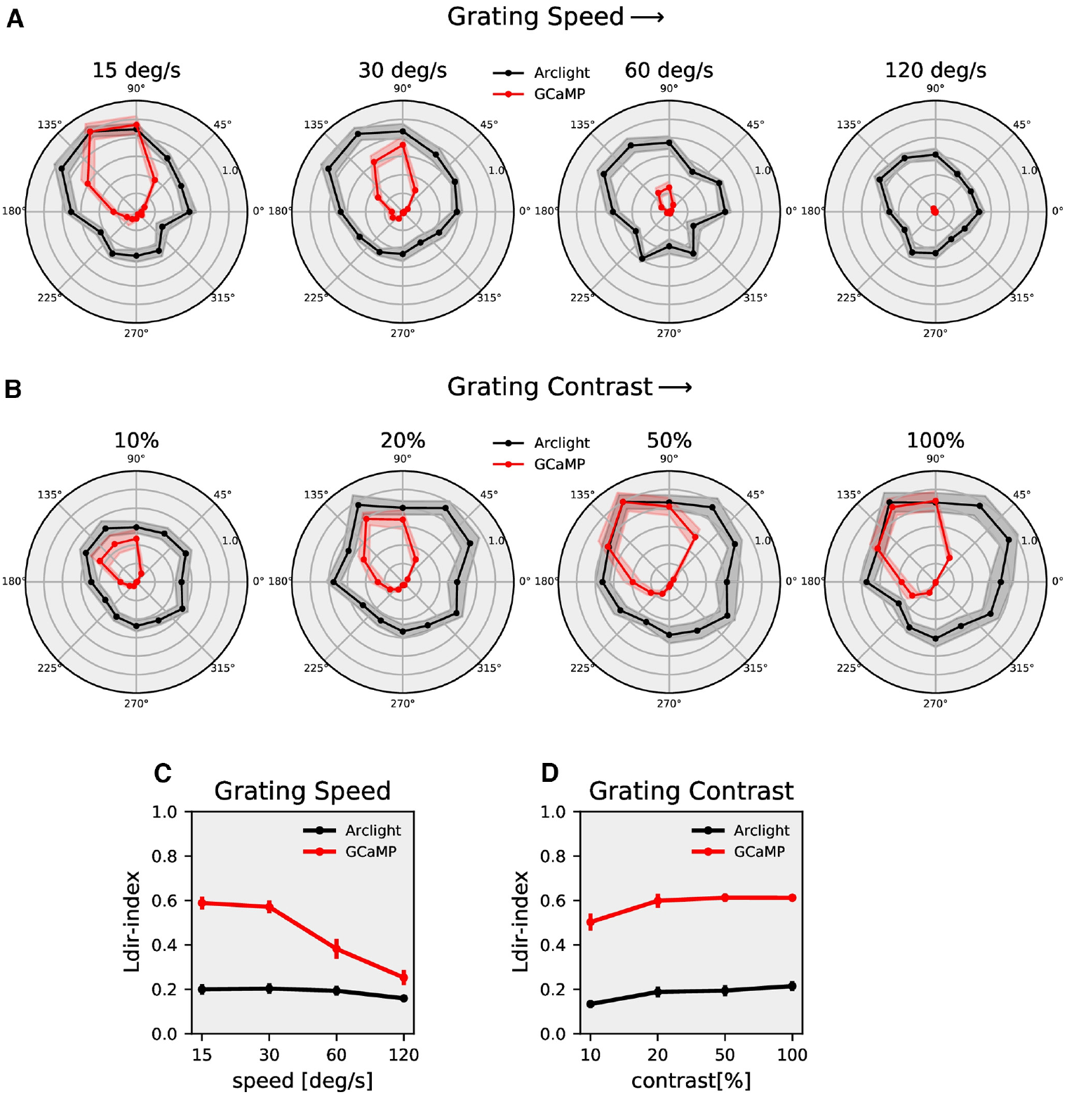
Calcium signals differ from synaptic computations
A neuron's directional tuning is its response across motion directions. Mishra and colleagues measured T4c responses to gratings moving in 12 directions, across four speeds and contrasts from 10% to 100%, using voltage and calcium indicators.
Calcium tuning was narrower and more direction-selective than voltage tuning under the tested conditions. Both signals changed with speed and contrast, but their relative sensitivity differed. The readout is therefore part of the experimentally observed transformation from visual input to neural output.
The authors compared published filtering and nonlinear-transform models with the measurements. A successful model describes the relationship between indicators; it does not identify a unique channel or synaptic receptor. Synaptic direction computation and the later voltage-to-calcium transformation are distinct contributions that can coexist within T4.
Mishra et al. (2023), Fig. 1(A, B). T4c anatomy.
Mishra et al. (2023), Fig. 4. Voltage and calcium directional tuning across speed and contrast.
Mishra et al. (2023)
36
Notes:
• Testing twelve directions distinguishes tuning width from the simple preferred-versus-null comparison. A neuron may respond weakly to its exact null direction yet still respond broadly to other directions.
• The calcium response was more selective than the voltage response over the tested stimulus set, and the difference depended on speed and contrast. The properties of the activity variable measured therefore affect the apparent strength of selectivity.
• The fitted transformations contain temporal filtering and nonlinear operations. Their agreement with the data is an input-output account, whereas selecting a specific calcium channel as the cause would require additional molecular and physiological experiments.
References:
Mishra A, Serbe-Kamp E, Borst A, Haag J (2023). Voltage to Calcium Transformation Enhances Direction Selectivity in Drosophila T4 Neurons. Journal of Neuroscience 43:2497-2514. https://doi.org/10.1523/jneurosci.2297-22.2023
Figure: Mishra et al. (2023), Fig. 4. Voltage and calcium directional tuning across speed and contrast.
Figure source: https://doi.org/10.1523/jneurosci.2297-22.2023
Figure: Mishra et al. (2023), Fig. 1(A, B). T4c anatomy.
Figure source: https://doi.org/10.1523/jneurosci.2297-22.2023

Slide 37
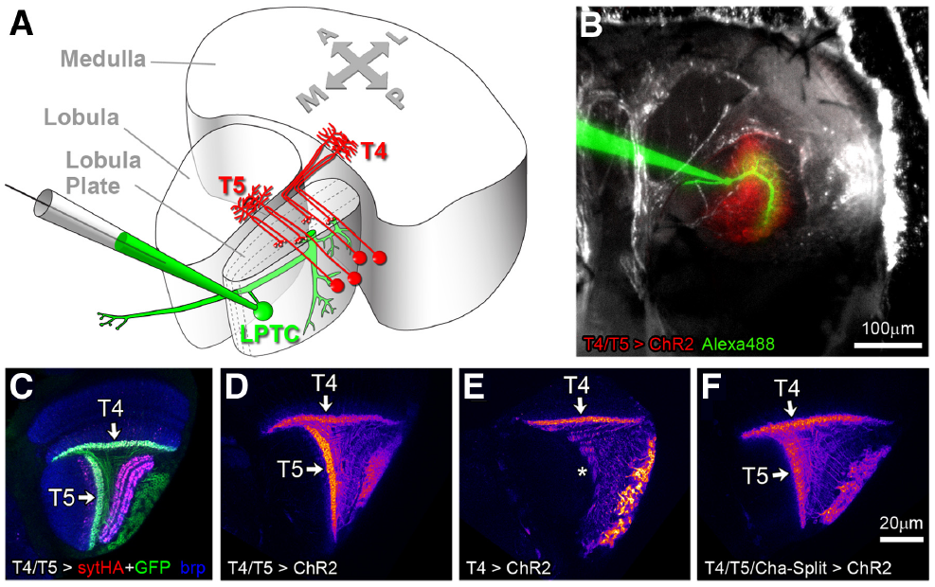
Lobula plate neurons pool many local motion signals
Lobula plate tangential cells, or LPTCs, extend dendrites across many local motion channels. Spatial pooling combines activity from multiple visual locations, allowing these neurons to represent broad optic-flow patterns rather than only one neighboring pair of inputs.
Schnell and colleagues recorded horizontal-system and vertical-system cells, which favor horizontal and vertical flow components. Blocking T4/T5 output removed motion-dependent voltage responses while leaving responses to brightness flicker. The wide-field directional signal therefore depends on the local detector population.
Mauss and colleagues labeled T4/T5 terminals together with recorded LPTCs, relating the input population to its downstream targets. Pooling explains a change in spatial scale; its anatomical presence does not specify the complete transformation from lobula plate activity to steering torque or walking turns.
Schnell et al. (2012), Fig. 2. Motion responses disappear while flicker responses persist.
Mauss et al. (2014), Fig. 1(A–F). Local motion neurons contact lobula plate tangential cells.
Schnell et al. (2012); Mauss et al. (2014)
37
Notes:
• A local detector evaluates motion over a restricted part of the visual field. A tangential cell samples many such outputs, so the resulting response can reflect a broad distribution of motion across the eye.
• Horizontal-system and vertical-system neurons are wide-field cells with different preferred flow components. Their motion responses depend on T4/T5 transmission, whereas retained flicker responses provide a control against complete visual or recording failure.
• Contact tracing and labeling connect the local detector population to the wide-field cell. They do not establish the full motor pathway: a cell's response to optic flow can provide a steering signal without determining every detail of the eventual movement.
References:
Schnell B, Raghu SV, Nern A, Borst A (2012). Columnar cells necessary for motion responses of wide-field visual interneurons in Drosophila. Journal of Comparative Physiology A 198:389-395. https://doi.org/10.1007/s00359-012-0716-3
Mauss AS, Meier M, Serbe E, Borst A (2014). Optogenetic and pharmacologic dissection of feedforward inhibition in Drosophila motion vision. Journal of Neuroscience 34:2254-2263. https://doi.org/10.1523/jneurosci.3938-13.2014
Figure: Schnell et al. (2012), Fig. 2. Motion responses disappear while flicker responses persist.
Figure source: https://doi.org/10.1007/s00359-012-0716-3
Figure: Mauss et al. (2014), Fig. 1(A–F). Local motion neurons contact lobula plate tangential cells.
Figure source: https://doi.org/10.1523/jneurosci.3938-13.2014

Slide 38
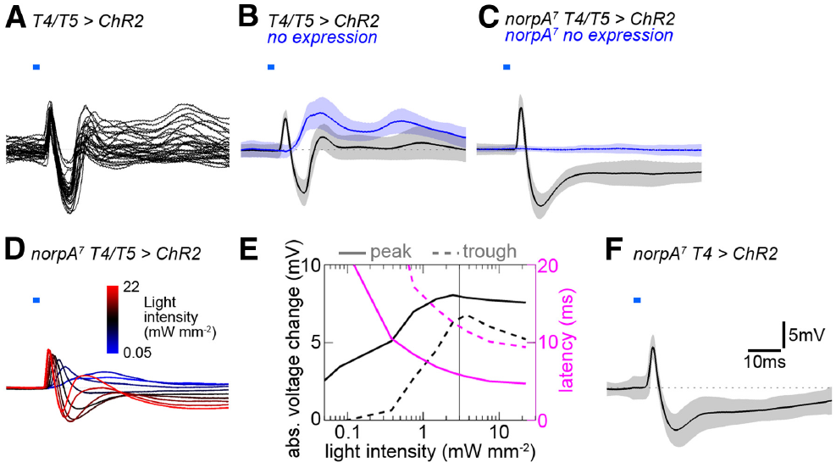
T4 and T5 activation excites tangential cells
Optogenetics uses a light-sensitive protein to manipulate selected neurons. Mauss and colleagues expressed channelrhodopsin-2, a light-gated cation channel, in T4/T5 and recorded downstream LPTC membrane voltage during 2-ms blue-light pulses.
Selective activation produced a fast depolarizing peak at approximately 5.4 ms followed by an inhibitory trough near 11 ms. Depolarization makes membrane potential less negative; hyperpolarization makes it more negative. These response components have different timing despite the same initiating stimulus.
Flies lacking channelrhodopsin provided a light-stimulation control, and visually blind norpA preparations reduced contamination from ordinary retinal responses. The experiments establish a rapid excitatory route from T4/T5 to LPTCs; the later inhibitory component requires an additional explanation rather than a second assumed direct transmitter action.
Mauss et al. (2014), Fig. 2. Brief optogenetic pulses evoke fast excitation and delayed inhibition.
Mauss et al. (2014), Fig. 1(A–F). Labeled T4/T5 inputs and the recorded tangential cell.
Mauss et al. (2014)
38
Notes:
• Channelrhodopsin allows the investigator to activate genetically selected cells without relying on the visual stimulus that normally drives them. The blue pulse initiates activity in T4/T5, and the downstream electrode measures the resulting membrane response.
• The fast peak preceded the inhibitory trough by several milliseconds. These are response peak times under the pulse protocol, not the delay fitted for the behavioral Reichardt model.
• A control without the light-sensitive protein identifies effects of the flash itself. The norpA blind preparation further separates optogenetic activation from phototransduction. Together the controls strengthen the assignment of the recorded response to T4/T5 transmission.
References:
Mauss AS, Meier M, Serbe E, Borst A (2014). Optogenetic and pharmacologic dissection of feedforward inhibition in Drosophila motion vision. Journal of Neuroscience 34:2254-2263. https://doi.org/10.1523/jneurosci.3938-13.2014
Figure: Mauss et al. (2014), Fig. 2. Brief optogenetic pulses evoke fast excitation and delayed inhibition.
Figure source: https://doi.org/10.1523/jneurosci.3938-13.2014
Figure: Mauss et al. (2014), Fig. 1(A–F). Labeled T4/T5 inputs and the recorded tangential cell.
Figure source: https://doi.org/10.1523/jneurosci.3938-13.2014

Slide 39
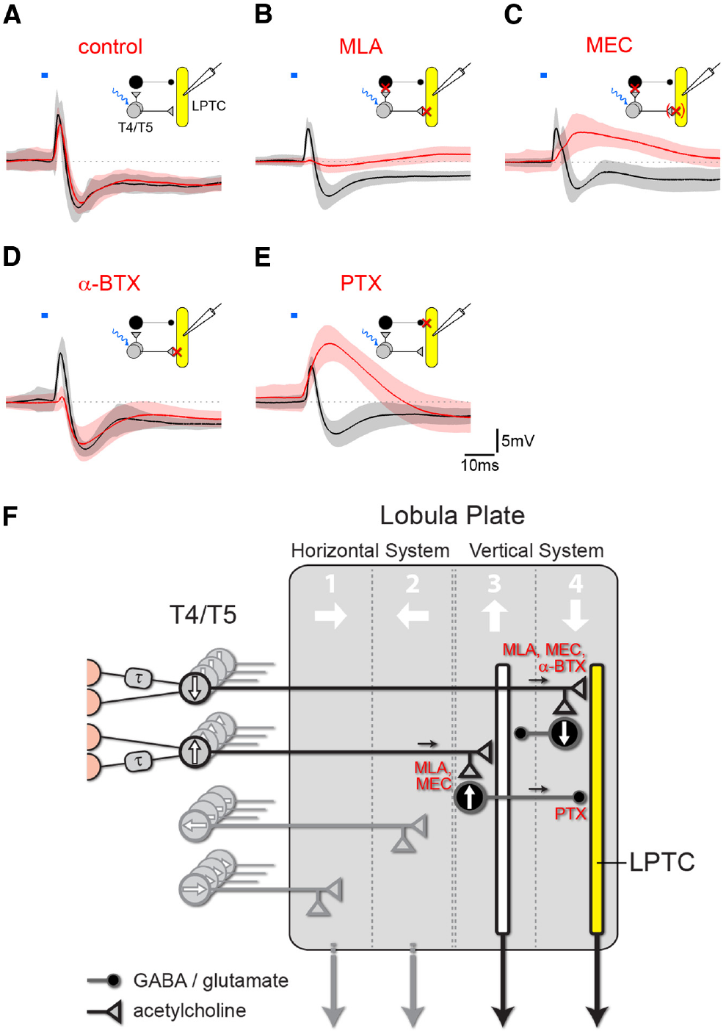
Feedforward inhibition supplies opposite-direction signals
Feedforward inhibition occurs when an upstream neuron activates an intervening inhibitory neuron that suppresses a downstream target. Mauss and colleagues combined T4/T5 optogenetic stimulation with antagonists, drugs that reduce signaling through particular receptor classes.
Blocking nicotinic acetylcholine receptors with methyllycaconitine strongly reduced both response components. α-Bungarotoxin preferentially reduced fast excitation, whereas picrotoxin removed inhibition and increased excitation. The different profiles support direct cholinergic excitation plus an indirectly recruited inhibitory route.
Picrotoxin at 25 µM also reduced responses to pressure-applied GABA and glutamate, so it did not uniquely identify GABA transmission. The intermediate inhibitory cell was not identified in this study. Receptor pharmacology constrains circuit organization without proving one exclusive inhibitory transmitter or a complete cell-by-cell pathway.
Mauss et al. (2014), Fig. 5(A–F). Pharmacology and the published feedforward circuit.
Mauss et al. (2014)
39
Notes:
• Nicotinic acetylcholine receptors are ligand-gated ion channels through which acetylcholine can directly excite a receiving neuron. Blocking cholinergic activation can suppress both the direct target and an inhibitory neuron activated upstream of it.
• The loss of inhibition after picrotoxin, together with enhanced remaining excitation, supports an inhibitory conductance opposing the fast excitatory response. Different sensitivities to the cholinergic antagonists are consistent with different receptor populations on the direct and indirect routes.
• The drug controls limit transmitter specificity. Picrotoxin affected glutamate-evoked inhibition as well as GABA-evoked inhibition, so assigning the entire indirect pathway to GABA on that drug result alone would be unjustified.
References:
Mauss AS, Meier M, Serbe E, Borst A (2014). Optogenetic and pharmacologic dissection of feedforward inhibition in Drosophila motion vision. Journal of Neuroscience 34:2254-2263. https://doi.org/10.1523/jneurosci.3938-13.2014
Figure: Mauss et al. (2014), Fig. 5(A–F). Pharmacology and the published feedforward circuit.
Figure source: https://doi.org/10.1523/jneurosci.3938-13.2014

Slide 40
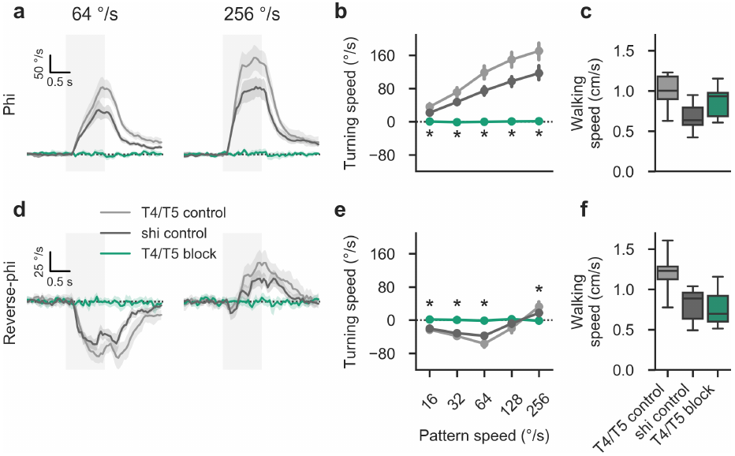
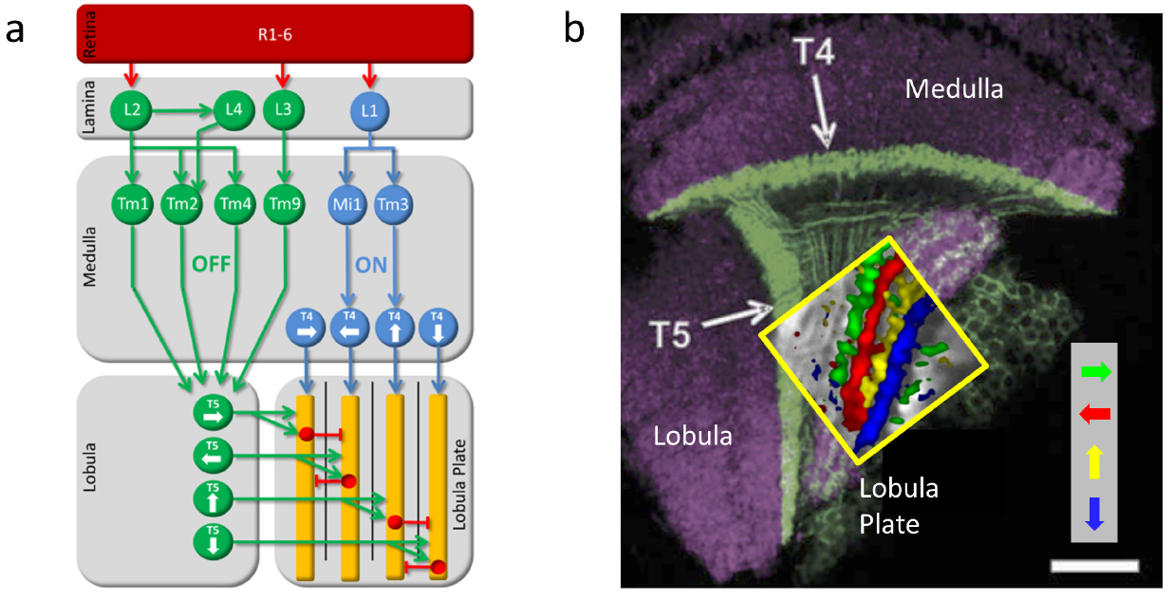
Reverse-phi turning requires T4 and T5
A motion illusion can use the same early circuit as an ordinary stabilizing response. Leonhardt and colleagues suppressed T4/T5 synaptic output and measured turning during phi and reverse-phi stimulation in tethered walking flies.
Control flies turned with ordinary motion and against slower reverse-phi motion. T4/T5-blocked flies lost both responses, including the high-velocity re-inversion of reverse-phi turning. Genetic controls retained directional responses under the same test conditions.
Forward walking speed remained comparable across the tested genotypes. The behavioral deficit therefore was not explained by an inability to walk. T4/T5 are necessary for these directional responses, but joint silencing does not establish which pathway or synaptic interaction generates each component of the illusion.
Leonhardt et al. (2017), Fig. 4. T4/T5 silencing removes turning but preserves walking.
Haag et al. (2016), Fig. 1(a, b). Local ON and OFF pathway anatomy.
Leonhardt et al. (2017); Haag et al. (2016)
40
Notes:
• The same silencing manipulation affected both ordinary and illusory motion responses. That shared dependence makes a separate route bypassing T4/T5 unnecessary for the tested reverse-phi behavior.
• The controls retained the velocity-dependent reversals, while the combined T4/T5 block abolished turning responses across those conditions. The manipulation targeted output from the local detector population rather than measuring a model prediction alone.
• Comparable forward walking is a motor control with a specific scope. It argues against general locomotor failure but does not prove that every motor function is unaffected, and it does not distinguish the individual contributions of T4 and T5.
References:
Leonhardt A, Meier M, Serbe E, Eichner H, Borst A (2017). Neural mechanisms underlying sensitivity to reverse-phi motion in the fly. PLoS ONE 12:e0189019. https://doi.org/10.1371/journal.pone.0189019
Haag J, Arenz A, Serbe E, Gabbiani F, Borst A (2016). Complementary mechanisms create direction selectivity in the fly. eLife 5:e17421. https://doi.org/10.7554/elife.17421
Figure: Leonhardt et al. (2017), Fig. 4. T4/T5 silencing removes turning but preserves walking.
Figure source: https://doi.org/10.1371/journal.pone.0189019
Figure: Haag et al. (2016), Fig. 1(a, b). Local ON and OFF pathway anatomy.
Figure source: https://doi.org/10.7554/elife.17421

Slide 41
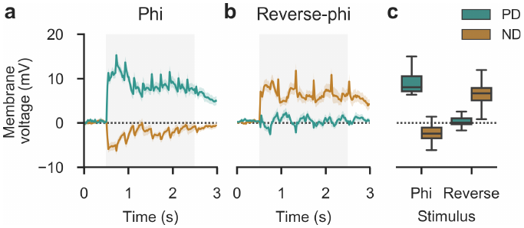
Tangential cells can encode an illusory direction
A patch-clamp recording measures electrical activity through an electrode contacting a neuronal membrane. Leonhardt and colleagues recorded tangential-cell voltage during phi and reverse-phi gratings with wavelength 45°, speed 128°/s and step width 6°.
Ordinary preferred-direction motion depolarized the cells, and ordinary null-direction motion hyperpolarized them. Reverse-phi displaced in the null direction instead produced depolarization, though weaker than the ordinary preferred-direction response. Reverse-phi displaced in the preferred direction produced little detectable voltage deflection.
The neuronal response therefore partially inverted with the illusion rather than simply reproducing every behavioral response symmetrically. Direct voltage recordings distinguish hyperpolarization from a fluorescence signal near zero. Agreement between neural and behavioral direction supports an early sensory contribution without proving a complete one-to-one mapping onto turning.
Leonhardt et al. (2017), Fig. 5. Patch-clamp responses to phi and reverse-phi motion.
Mauss et al. (2014), Fig. 1(A–F). Lobula plate inputs and tangential-cell anatomy.
Leonhardt et al. (2017); Mauss et al. (2014)
41
Notes:
• Voltage recordings can resolve opposite electrical response signs. A calcium measurement near baseline cannot by itself distinguish lack of excitation from active hyperpolarization.
• The same tangential-cell preparation was tested with both stimulus types and both directions. Ordinary motion produced the expected depolarizing and hyperpolarizing responses, but contrast reversal changed the response to a physically null-direction displacement.
• The inversion was incomplete: reverse-phi preferred-direction displacement did not simply reproduce a strong null-direction hyperpolarization. That asymmetry is a constraint on the circuit mechanism and prevents the illusion from being described as a perfect sign reversal at every neural stage.
References:
Leonhardt A, Meier M, Serbe E, Eichner H, Borst A (2017). Neural mechanisms underlying sensitivity to reverse-phi motion in the fly. PLoS ONE 12:e0189019. https://doi.org/10.1371/journal.pone.0189019
Mauss AS, Meier M, Serbe E, Borst A (2014). Optogenetic and pharmacologic dissection of feedforward inhibition in Drosophila motion vision. Journal of Neuroscience 34:2254-2263. https://doi.org/10.1523/jneurosci.3938-13.2014
Figure: Leonhardt et al. (2017), Fig. 5. Patch-clamp responses to phi and reverse-phi motion.
Figure source: https://doi.org/10.1371/journal.pone.0189019
Figure: Mauss et al. (2014), Fig. 1(A–F). Lobula plate inputs and tangential-cell anatomy.
Figure source: https://doi.org/10.1523/jneurosci.3938-13.2014

Slide 42
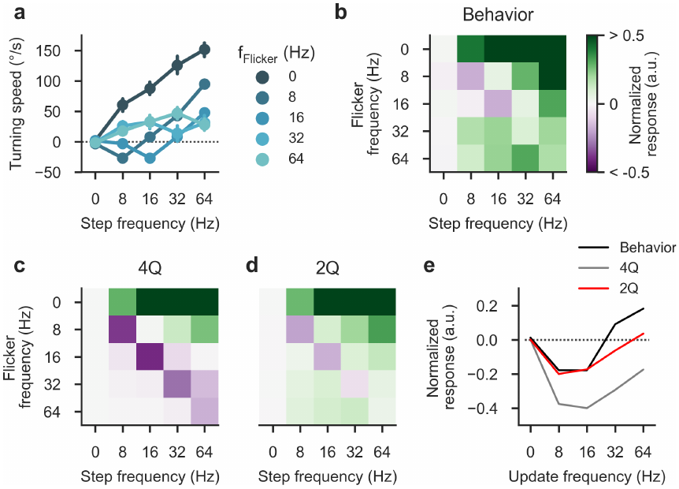

Bright and dark motion pathways can interact
Rectification preferentially retains one sign of an input signal. A motion model that completely rectifies bright and dark signals into independent channels can lose the cross-polarity interactions required for reverse-phi responses. Separate ON and OFF pathways therefore need a more precise computational description.
Leonhardt and colleagues varied flicker frequency independently of spatial-step frequency. Behavioral responses changed with both, constraining explanations based only on physical displacement. A published two-quadrant model including a constant-luminance component captured important features of the measured reversal.
The model offers an account of effective pathway interactions, not a uniquely established receptor mechanism. Clark's polarity tests and Leonhardt's dissociated stimuli both require sensitivity beyond two isolated, perfectly rectified streams. Anatomical ON/OFF separation remains compatible with functional influence from both contrast signs.
Leonhardt et al. (2017), Fig. 9. Measured responses and published detector predictions.
Leonhardt et al. (2017), Fig. 6. Published four- and two-quadrant computational accounts.
Leonhardt et al. (2017); Clark et al. (2011)
42
Notes:
• Rectification means retaining or emphasizing one sign after a signal transformation. Complete removal of the opposite sign can prevent a model from responding to contrast-reversing sequences in the way that flies do.
• Separately controlling flicker and spatial displacement tested whether response direction depended on the temporal contrast events as well as the steps. The resulting response map supplied more constraints than one ordinary-versus-reverse comparison.
• The two-quadrant model included a baseline luminance contribution, allowing effective opposite-polarity influences without requiring direct multiplication of every ON and OFF pair. Its fit is a proposed computational account; it does not identify the cellular origin of that baseline term.
References:
Leonhardt A, Meier M, Serbe E, Eichner H, Borst A (2017). Neural mechanisms underlying sensitivity to reverse-phi motion in the fly. PLoS ONE 12:e0189019. https://doi.org/10.1371/journal.pone.0189019
Clark DA, Bursztyn L, Horowitz MA, Schnitzer MJ, Clandinin TR (2011). Defining the computational structure of the motion detector in Drosophila. Neuron 70:1165-1177. https://doi.org/10.1016/j.neuron.2011.05.023
Figure: Leonhardt et al. (2017), Fig. 9. Measured responses and published detector predictions.
Figure source: https://doi.org/10.1371/journal.pone.0189019
Figure: Leonhardt et al. (2017), Fig. 6. Published four- and two-quadrant computational accounts.
Figure source: https://doi.org/10.1371/journal.pone.0189019

Slide 43

Sustained high contrast can reverse optomotor turning
Reverse-phi changes stimulus contrast sign between frames. Anti-directional turning in Mano's experiments occurred during continuously drifting sinusoidal gratings without such contrast reversals, so the two behavioral reversals have different stimulus definitions.
With wavelength 60°, temporal frequency 1 Hz and contrast 1.0, flies initially turned with the pattern and then against it after approximately 1–2 s. At contrast 0.25, the turn remained aligned with the stimulus. The pattern's physical motion did not reverse.
Spatial and temporal tuning also differed between the initial 0.5-s response and the later 1–4-s response. A fixed mapping from local motion direction to stabilizing turns cannot explain the full time course. Downstream dynamics or adaptation are required, but the behavioral timing alone does not identify their circuit location.
Mano et al. (2023), Fig. 2(a, b). Early and late turning differ across spatial and temporal frequency.
Mano et al. (2023), Fig. 1(b, c). Turning changes sign during an unchanged high-contrast stimulus.
Mano et al. (2023)
43
Notes:
• The anti-directional response used an ordinary drifting grating. Its contrast remained defined in the same way over time, unlike reverse-phi, where the bright and dark regions swap at each displacement.
• High contrast produced a delayed change in turning direction, while lower contrast produced sustained turning with the pattern. Because the external motion remained unchanged, the time dependence arises in the animal's processing or response rather than from a reversal of the stimulus.
• Comparing early and late response maps reveals different tuning. A single measurement averaged over the whole stimulus would hide those dynamics and could mischaracterize the direction and strength of the optomotor response.
References:
Mano O, Choi M, Tanaka R, Creamer MS, Matos NCB, Shomar JW, Badwan BA, Clandinin TR, Clark DA (2023). Long-timescale anti-directional rotation in <i>Drosophila</i> optomotor behavior. eLife 12:e86076. https://doi.org/10.7554/elife.86076
Figure: Mano et al. (2023), Fig. 2(a, b). Early and late turning differ across spatial and temporal frequency.
Figure source: https://doi.org/10.7554/elife.86076
Figure: Mano et al. (2023), Fig. 1(b, c). Turning changes sign during an unchanged high-contrast stimulus.
Figure source: https://doi.org/10.7554/elife.86076

Slide 44

Behavioral reversals need not originate in T4 or T5
A neuron can be necessary for a behavior without generating every temporal transformation within that behavior. Mano and colleagues silenced T4/T5 and eliminated both ordinary and delayed anti-directional turning during the tested gratings.
Calcium imaging of T4, T5 and several lobula plate cell classes did not reveal a reversal or decay matching the behavioral switch. Preferred-direction signals persisted over the interval in which the fly's turn changed sign; null-direction activity remained comparatively weak.
The results support a transformation downstream of the sampled lobula plate signals. They do not prove that every early neuron lacks relevant dynamics, because the recordings sampled selected populations and calcium activity. Necessity of T4/T5 and localization of the slow behavioral reversal are different experimental conclusions.
Mano et al. (2023), Fig. 5(a–e). T4, T5, HS and CH responses during sustained motion.
Mano et al. (2023)
44
Notes:
• Silencing establishes that the detector output is required for both the early and late turns. It does not establish that the sign change is already present in the detector's output.
• The imaging experiments tested that localization by following activity over a matching prolonged stimulus. Direction-selective visual neurons retained signals favoring their preferred direction while the behavioral response inverted.
• A downstream transformation is therefore supported by the difference between the sampled neural time courses and behavior. The conclusion has a sampling limit: unrecorded cells, electrical signals not captured by calcium, or more complex population interactions could still contribute.
References:
Mano O, Choi M, Tanaka R, Creamer MS, Matos NCB, Shomar JW, Badwan BA, Clandinin TR, Clark DA (2023). Long-timescale anti-directional rotation in <i>Drosophila</i> optomotor behavior. eLife 12:e86076. https://doi.org/10.7554/elife.86076
Figure: Mano et al. (2023), Fig. 5(a–e). T4, T5, HS and CH responses during sustained motion.
Figure source: https://doi.org/10.7554/elife.86076

Slide 45

Age and light exposure alter optomotor dynamics
Eclosion is the emergence of an adult insect from its pupal case. Mano and colleagues measured prolonged optomotor turning at different ages after eclosion, testing whether the balance between ordinary and anti-directional responses was fixed in adulthood.
Across 1, 2, 4 and 8 days, Drosophila melanogaster shifted toward more sustained turning with the stimulus. Dark-reared flies retained a stronger juvenile-like decrease or reversal. Comparable experiments in another laboratory also detected age and light-exposure effects.
The finding supports visual-experience-dependent maturation of sensorimotor responses. It does not identify the altered synapse or prove a single learning mechanism. The same article found different age dependence in Drosophila yakuba, so plasticity cannot be assumed identical even among closely related fly species.
Mano et al. (2023), Fig. 6. Adult age and dark rearing change prolonged turning.
Mano et al. (2023)
45
Notes:
• Eclosion provides a defined starting point for adult age. Measuring the same stimulus at several ages separates an adult developmental change from a comparison between unrelated visual patterns.
• Older fruit flies showed a more sustained ordinary response, while reduced visual exposure preserved more juvenile-like dynamics. The dark-rearing comparison supports a contribution from visual experience in addition to elapsed time after emergence.
• The species comparison limits generalization. Drosophila yakuba retained more stable anti-directional responses over the examined early adult interval, so experience-dependent changes in one species do not imply the same maturation process in every drosophilid.
References:
Mano O, Choi M, Tanaka R, Creamer MS, Matos NCB, Shomar JW, Badwan BA, Clandinin TR, Clark DA (2023). Long-timescale anti-directional rotation in <i>Drosophila</i> optomotor behavior. eLife 12:e86076. https://doi.org/10.7554/elife.86076
Figure: Mano et al. (2023), Fig. 6. Adult age and dark rearing change prolonged turning.
Figure source: https://doi.org/10.7554/elife.86076

Slide 46
Key takeaways
Optomotor turning couples panoramic image motion to steering; stimulus contrast, spatial scale and elapsed time affect the response.
The Reichardt detector compares neighboring signals with unequal temporal filtering, nonlinear interaction and opponent subtraction; it specifies a computation rather than a unique two-neuron circuit.
Stimulus structure matters: temporal frequency tuning and reverse-phi responses follow from relationships between space, time and contrast polarity, so local detector output is not a pattern-independent velocity estimate.
Parallel ON and OFF pathways use T4 and T5, respectively; four subtypes of each converge in direction-specific lobula plate layers.
Complementary mechanisms include preferred-direction enhancement and null-direction suppression. Connectomes, transmitter markers, receptor transcripts and voltage/calcium measurements supply distinct kinds of evidence.
Wide-field and motor transformations follow local detection. T4/T5 are necessary for ordinary and reversed turns, while prolonged responses and maturation require additional sensorimotor dynamics.
Hassenstein & Reichardt (1956); Clark et al. (2011); Haag et al. (2016, 2017); Mano et al. (2023)
46
Notes:
Hassenstein B, Reichardt W (1956). Systemtheoretische Analyse der Zeit-, Reihenfolgen- und Vorzeichenauswertung bei der Bewegungsperzeption des Rüsselkäfers Chlorophanus. Zeitschrift für Naturforschung B 11:513–524. https://doi.org/10.1515/znb-1956-9-1004
Clark DA, Bursztyn L, Horowitz MA, Schnitzer MJ, Clandinin TR (2011). Defining the computational structure of the motion detector in Drosophila. Neuron 70:1165-1177. https://doi.org/10.1016/j.neuron.2011.05.023
Duistermars BJ, Chow DM, Condro M, Frye MA (2007). The spatial, temporal and contrast properties of expansion and rotation flight optomotor responses in Drosophila. Journal of Experimental Biology 210:3218-3227. https://doi.org/10.1242/jeb.007807
Haag J, Arenz A, Serbe E, Gabbiani F, Borst A (2016). Complementary mechanisms create direction selectivity in the fly. eLife 5:e17421. https://doi.org/10.7554/elife.17421
Haag J, Mishra A, Borst A (2017). A common directional tuning mechanism of Drosophila motion-sensing neurons in the ON and in the OFF pathway. eLife 6:e29044. https://doi.org/10.7554/elife.29044
Takemura SY, Nern A, Chklovskii DB, Scheffer LK, Rubin GM, Meinertzhagen IA (2017). The comprehensive connectome of a neural substrate for 'ON' motion detection in Drosophila. eLife 6:e24394. https://doi.org/10.7554/elife.24394
Shinomiya K, Huang G, Lu Z, Parag T, Xu CS, Aniceto R, Ansari N, Cheatham N, Lauchie S, Neace E, Ogundeyi O, Ordish C, Peel D, Shinomiya A, Smith C, Takemura S, Talebi I, Rivlin PK, Nern A, Scheffer LK, Plaza SM, Meinertzhagen IA (2019). Comparisons between the ON- and OFF-edge motion pathways in the Drosophila brain. eLife 8:e40025. https://doi.org/10.7554/elife.40025
Mauss AS, Meier M, Serbe E, Borst A (2014). Optogenetic and pharmacologic dissection of feedforward inhibition in Drosophila motion vision. Journal of Neuroscience 34:2254-2263. https://doi.org/10.1523/jneurosci.3938-13.2014
Pankova K, Borst A (2016). RNA-Seq Transcriptome Analysis of Direction-Selective T4/T5 Neurons in Drosophila. PLoS ONE 11:e0163986. https://doi.org/10.1371/journal.pone.0163986
Mishra A, Serbe-Kamp E, Borst A, Haag J (2023). Voltage to Calcium Transformation Enhances Direction Selectivity in Drosophila T4 Neurons. Journal of Neuroscience 43:2497-2514. https://doi.org/10.1523/jneurosci.2297-22.2023
Mano O, Choi M, Tanaka R, Creamer MS, Matos NCB, Shomar JW, Badwan BA, Clandinin TR, Clark DA (2023). Long-timescale anti-directional rotation in <i>Drosophila</i> optomotor behavior. eLife 12:e86076. https://doi.org/10.7554/elife.86076

