Slide 1
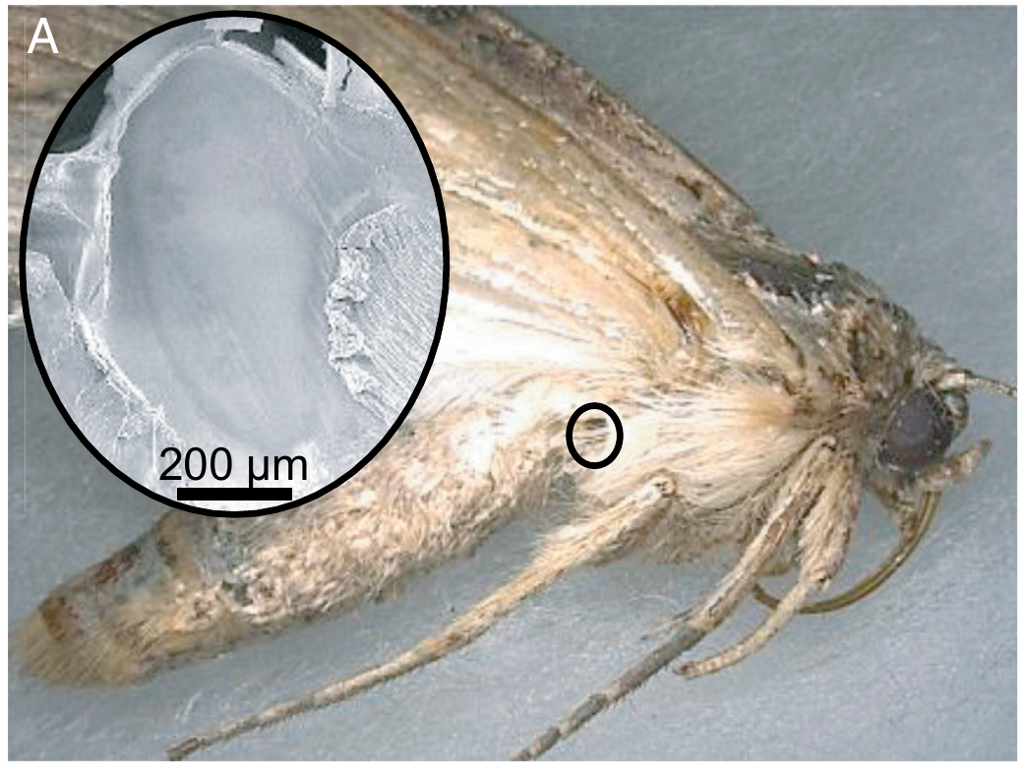
NEUR 411 · NEUROETHOLOGY · FALL 2026
Lecture 15
Insect hearing II: moth ears and bat-evasion behavior (Roeder)
Monday, September 28, 2026
Jordan Lopez, Ph.D.
Professor of Neurobiology & Biomedical Engineering
Nakano et al. (2022), Fig. 1(A). S. litura and its tympanal ear. DOI: 10.1073/pnas.2211007119
Notes:
Insect hearing II: moth ears and bat-evasion behavior (Roeder)
Lecture 15. NEUR 411 · NEUROETHOLOGY · FALL 2026. Monday, September 28, 2026.
Figure: Nakano et al. (2022), Fig. 1(A). Published specimen photograph and ear micrograph; original 200-µm scale bar retained.
References:
Nakano R, Ito A, Tokumaru S (2022). Sustainable pest control inspired by prey–predator ultrasound interactions. Proceedings of the National Academy of Sciences 119(43): e2211007119. https://doi.org/10.1073/pnas.2211007119

Slide 2
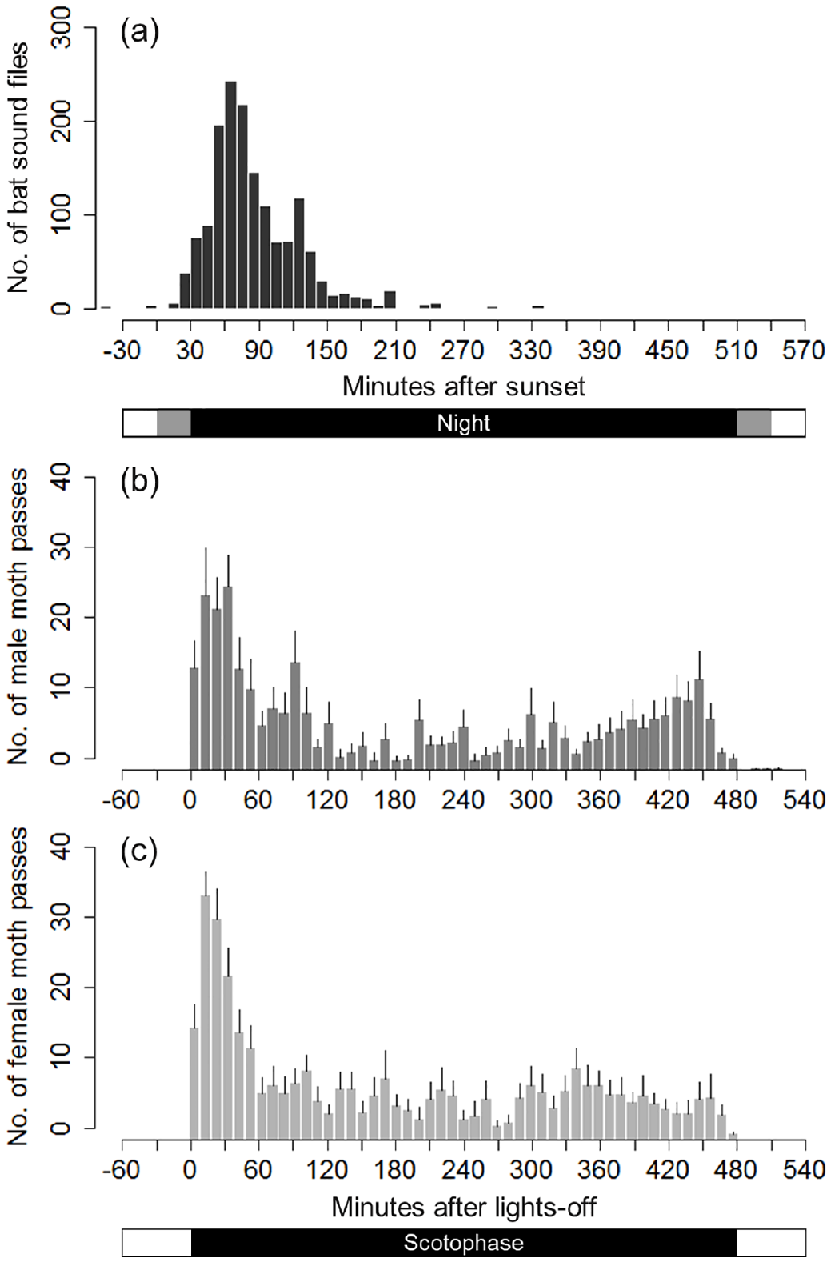
Moths encounter bats during their nocturnal activity
Echolocation locates objects from echoes of emitted sound. A moth can hear a bat’s outgoing ultrasonic calls without producing a signal itself. Ultrasound denotes frequencies above approximately 20 kHz; the calls therefore provide a potential predator cue outside ordinary human hearing.
Nakano and Mason recorded Eptesicus fuscus calls outdoors and measured movement of Nomophila nearctica, the lucerne moth, under a laboratory light cycle. Male and female moth activity was 98.6% and 99.2% nocturnal, respectively, with substantial activity early in the dark period.
Most bat recordings also occurred early at night: 93% fell 30–150 minutes after sunset. Temporal overlap makes encounters plausible, but separate activity records do not establish which individuals encountered one another or how often a particular moth was captured.
Nakano & Mason (2018), Fig. 2(a–c). Bat and moth activity distributions DOI: 10.1371/journal.pone.0202679
Nakano & Mason (2018)
02
Notes:
• Echolocation locates objects from echoes of emitted sound. A moth can hear a bat’s outgoing ultrasonic calls without producing a signal itself. Ultrasound denotes frequencies above approximately 20 kHz; the calls therefore provide a potential predator cue outside ordinary human hearing.
– The field bat recordings and laboratory moth records use different clocks. Sunset anchors the bat series, whereas lights-off anchors the moth series. Their overlap supports an ecological opportunity for predation, rather than a direct count of encounters.
• Nakano and Mason recorded Eptesicus fuscus calls outdoors and measured movement of Nomophila nearctica, the lucerne moth, under a laboratory light cycle. Male and female moth activity was 98.6% and 99.2% nocturnal, respectively, with substantial activity early in the dark period.
• Most bat recordings also occurred early at night: 93% fell 30–150 minutes after sunset. Temporal overlap makes encounters plausible, but separate activity records do not establish which individuals encountered one another or how often a particular moth was captured.
References:
Nakano R, Mason AC (2018). Early erratic flight response of the lucerne moth to the quiet echolocation calls of distant bats. PLOS ONE 13(8): e0202679. https://doi.org/10.1371/journal.pone.0202679
Figure: Nakano & Mason (2018), Fig. 2(a–c). Bat and moth activity distributions DOI: 10.1371/journal.pone.0202679
Figure source: https://doi.org/10.1371/journal.pone.0202679

Slide 3
Roeder linked ultrasonic input to defensive flight
Roeder treated bat avoidance as a connection between a controlled sensory input and an observable motor response. Noctuid moths could detect a distant bat and turn away from its ultrasonic source, making their ears accessible preparations for studying predator detection.
A restrained moth received artificial ultrasonic pulse trains approximating bat cries. Frequency, intensity, pulse duration, interpulse interval, and train duration could be varied separately. Neural recordings then identified which stimulus properties survived in the receptor and which were transformed by central neurons.
The sensitive receptor responded across roughly 15–80 kHz, but its spike signal did not provide a frequency measure within that band. Timing and intensity-related information remained available. These experiments established transformations of acoustic information; they did not identify every synapse generating a free-flight escape.
Roeder (1966)
03
Notes:
• Roeder treated bat avoidance as a connection between a controlled sensory input and an observable motor response. Noctuid moths could detect a distant bat and turn away from its ultrasonic source, making their ears accessible preparations for studying predator detection.
– The sensory preparation isolates acoustic variables that covary in a natural bat attack. A response to one controlled variable can establish sensitivity to that feature, but it cannot by itself establish how several changing features are combined during pursuit.
• A restrained moth received artificial ultrasonic pulse trains approximating bat cries. Frequency, intensity, pulse duration, interpulse interval, and train duration could be varied separately. Neural recordings then identified which stimulus properties survived in the receptor and which were transformed by central neurons.
• The sensitive receptor responded across roughly 15–80 kHz, but its spike signal did not provide a frequency measure within that band. Timing and intensity-related information remained available. These experiments established transformations of acoustic information; they did not identify every synapse generating a free-flight escape.
References:
Roeder KD (1966). Auditory system of noctuid moths. Science 154(3756): 1515–1521. https://doi.org/10.1126/science.154.3756.1515

Slide 4
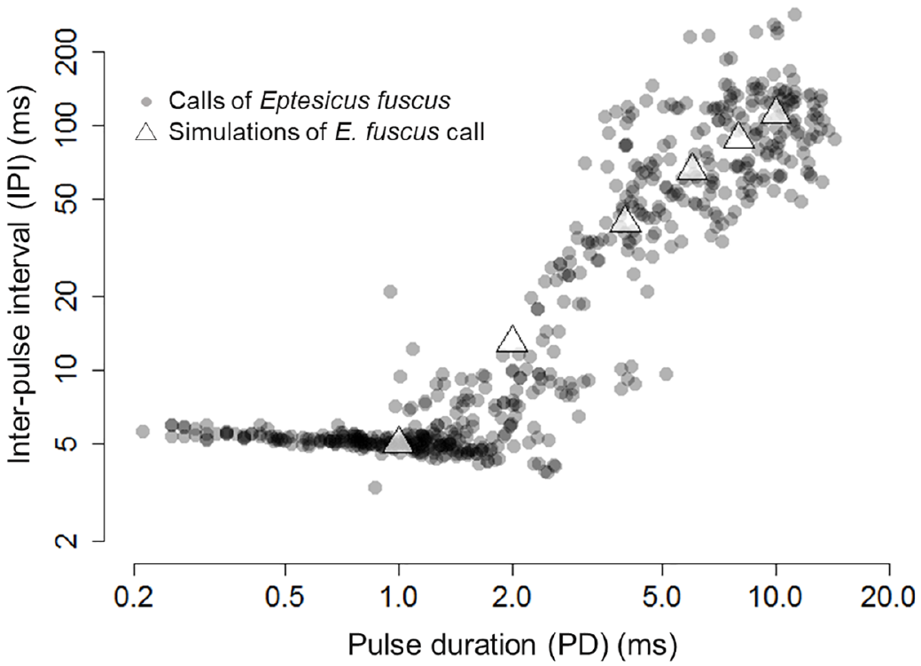
Bat call timing changes through an attack
An aerially hunting bat changes its acoustic sampling as it approaches prey. Pulse duration is the length of each call; the interpulse interval is the measured interval between calls. The terminal buzz is the rapid call sequence close to attempted capture.
Nakano and Mason recorded natural Eptesicus fuscus attack sequences. Mean call durations were 9.0 ms in search, 6.0 ms in approach, and 1.3 ms in the terminal buzz. Corresponding mean intervals were 122.0, 54.3, and 6.4 ms.
The investigators selected six representative temporal patterns for playback to moths. Recorded calls anchor those patterns in the predator’s behavior, but a pure-tone playback reproduces selected timing variables rather than the complete frequency sweep, beam direction, and moving source of a real bat.
Nakano & Mason (2018), Fig. 1. Recorded call durations and intervals DOI: 10.1371/journal.pone.0202679
Nakano & Mason (2018)
04
Notes:
• An aerially hunting bat changes its acoustic sampling as it approaches prey. Pulse duration is the length of each call; the interpulse interval is the measured interval between calls. The terminal buzz is the rapid call sequence close to attempted capture.
– Shorter intervals allow a bat to update target information more often. Moths receive this changing temporal sequence as sensory evidence about the predator. The playback design tests whether the sequence alters escape while holding other sound features under experimental control.
• Nakano and Mason recorded natural Eptesicus fuscus attack sequences. Mean call durations were 9.0 ms in search, 6.0 ms in approach, and 1.3 ms in the terminal buzz. Corresponding mean intervals were 122.0, 54.3, and 6.4 ms.
• The investigators selected six representative temporal patterns for playback to moths. Recorded calls anchor those patterns in the predator’s behavior, but a pure-tone playback reproduces selected timing variables rather than the complete frequency sweep, beam direction, and moving source of a real bat.
References:
Nakano R, Mason AC (2018). Early erratic flight response of the lucerne moth to the quiet echolocation calls of distant bats. PLOS ONE 13(8): e0202679. https://doi.org/10.1371/journal.pone.0202679
Figure: Nakano & Mason (2018), Fig. 1. Recorded call durations and intervals DOI: 10.1371/journal.pone.0202679
Figure source: https://doi.org/10.1371/journal.pone.0202679

Slide 5
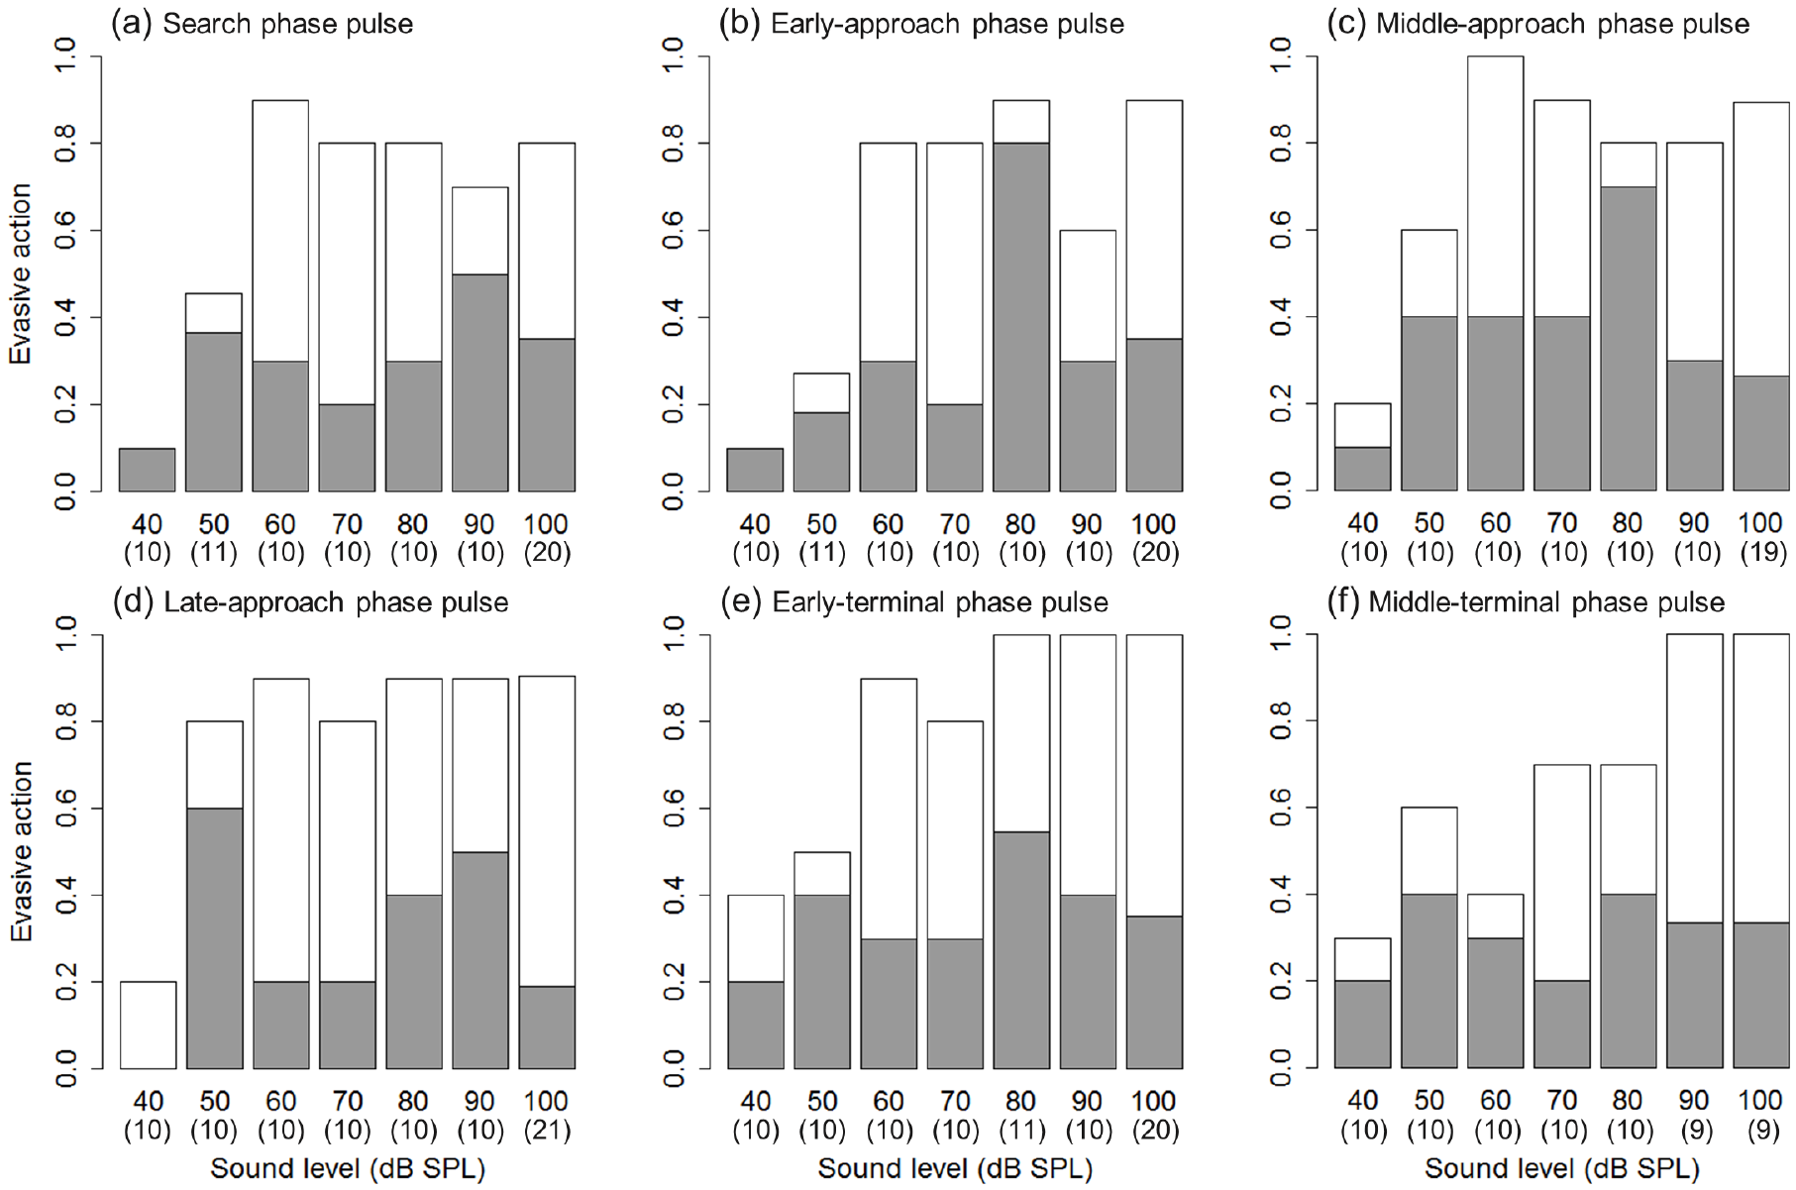
Escape need not wait for a terminal buzz
The lucerne moth has paired abdominal ears and responds to ultrasonic pulses with directed turning or erratic flight. Turning away changes course relative to the sound source; erratic flight includes loops, zigzags, and spirals with less predictable trajectories.
Nakano and Mason presented six bat-like temporal patterns at 30 kHz while varying sound level from 40 to 100 dB SPL. At a given level, search-like and later attack patterns did not produce clearly different response distributions. Both turning and erratic flight occurred.
Sound level affected the incidence of escape more than the tested temporal category. No passive flight cessation was observed in this species. A search-like pattern can therefore evoke erratic flight, and the conventional association between terminal calls and last-moment escape cannot be applied universally.
Nakano & Mason (2018), Fig. 3(a–f). Responses to six temporal patterns DOI: 10.1371/journal.pone.0202679
Nakano & Mason (2018)
05
Notes:
• The lucerne moth has paired abdominal ears and responds to ultrasonic pulses with directed turning or erratic flight. Turning away changes course relative to the sound source; erratic flight includes loops, zigzags, and spirals with less predictable trajectories.
– A tether allows a controlled sound to reach the moth while the observer classifies its attempted movements. Because the tether constrains displacement, these responses establish motor categories rather than the distance a free moth would travel or its survival probability.
• Nakano and Mason presented six bat-like temporal patterns at 30 kHz while varying sound level from 40 to 100 dB SPL. At a given level, search-like and later attack patterns did not produce clearly different response distributions. Both turning and erratic flight occurred.
• Sound level affected the incidence of escape more than the tested temporal category. No passive flight cessation was observed in this species. A search-like pattern can therefore evoke erratic flight, and the conventional association between terminal calls and last-moment escape cannot be applied universally.
References:
Nakano R, Mason AC (2018). Early erratic flight response of the lucerne moth to the quiet echolocation calls of distant bats. PLOS ONE 13(8): e0202679. https://doi.org/10.1371/journal.pone.0202679
Figure: Nakano & Mason (2018), Fig. 3(a–f). Responses to six temporal patterns DOI: 10.1371/journal.pone.0202679
Figure source: https://doi.org/10.1371/journal.pone.0202679

Slide 6
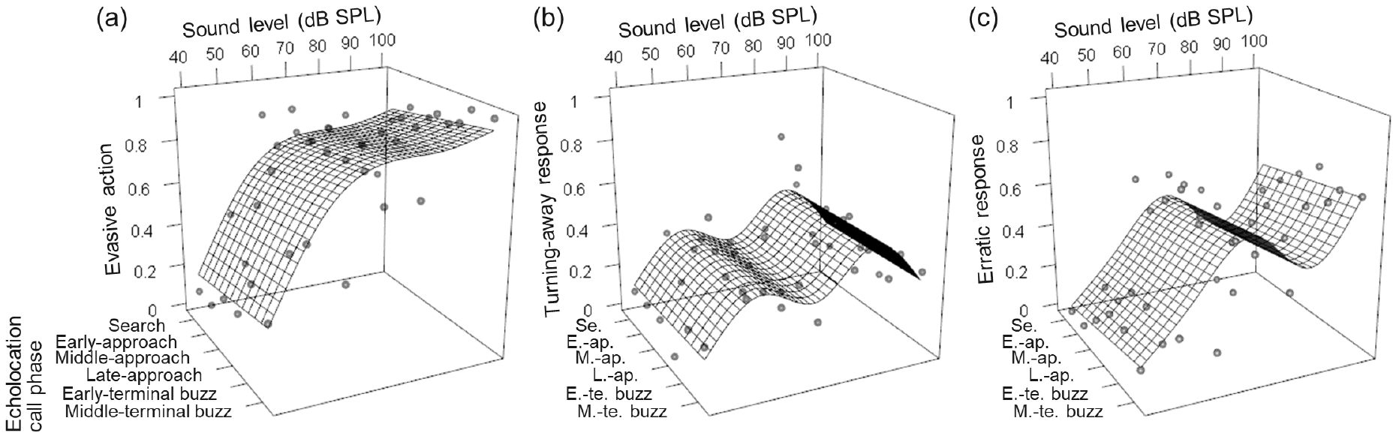
Quiet calls can already evoke erratic flight
Sound pressure level, dB SPL, reports acoustic pressure relative to 20 µPa. It is a measure at the receiver’s position, not a direct measurement of predator distance. Frequency, beam orientation, and atmospheric attenuation alter the level arriving at a moth.
Across the six temporal patterns, pooled escape occurred in 22% of trials at 40 dB SPL, 53% at 50 dB SPL, 82% at 60 dB SPL, and 91% at 100 dB SPL. Erratic flight was already frequent at 60 dB SPL.
The authors estimated that 60 dB SPL could correspond to an E. fuscus more than 20 m away under their acoustic assumptions. That estimate supports early avoidance as a plausible strategy; it does not mean every 60-dB call comes from a bat at that distance.
Nakano & Mason (2018), Fig. 4(a–c). Level-dependent escape responses DOI: 10.1371/journal.pone.0202679
Nakano & Mason (2018)
06
Notes:
• Sound pressure level, dB SPL, reports acoustic pressure relative to 20 µPa. It is a measure at the receiver’s position, not a direct measurement of predator distance. Frequency, beam orientation, and atmospheric attenuation alter the level arriving at a moth.
– Some movements at very low sound levels may resemble escape without being sound-evoked. The authors compared those levels with previously measured neural thresholds, so the strong response near 60 dB has firmer sensory support than the low-level response-like movements.
• Across the six temporal patterns, pooled escape occurred in 22% of trials at 40 dB SPL, 53% at 50 dB SPL, 82% at 60 dB SPL, and 91% at 100 dB SPL. Erratic flight was already frequent at 60 dB SPL.
• The authors estimated that 60 dB SPL could correspond to an E. fuscus more than 20 m away under their acoustic assumptions. That estimate supports early avoidance as a plausible strategy; it does not mean every 60-dB call comes from a bat at that distance.
References:
Nakano R, Mason AC (2018). Early erratic flight response of the lucerne moth to the quiet echolocation calls of distant bats. PLOS ONE 13(8): e0202679. https://doi.org/10.1371/journal.pone.0202679
Figure: Nakano & Mason (2018), Fig. 4(a–c). Level-dependent escape responses DOI: 10.1371/journal.pone.0202679
Figure source: https://doi.org/10.1371/journal.pone.0202679

Slide 7
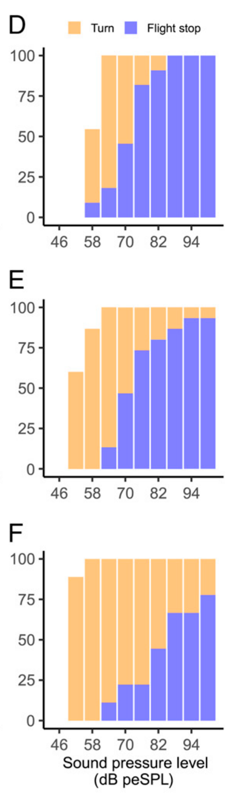
Moth lineages differ in their escape repertoire
A passive dive follows cessation of wing flapping, whereas an active evasive maneuver retains powered flight. These are different motor solutions to interception and cannot be inferred simply from the presence of an ultrasound-sensitive ear.
N. nearctica produced turning and erratic flight without passive dives in the tested preparation. By contrast, tethered Spodoptera litura, S. exigua, and S. frugiperda often stopped flapping during 5-ms ultrasonic pulses repeated at 10 Hz and delivered at 100 dB peSPL.
Flight stopped in 79.2%, 84.6%, and 83.3% of those respective Spodoptera trials. These results establish species-dependent behavioral output. They do not prove that the receptor count alone determines the motor repertoire or that tethered cessation has an identical outcome during free pursuit.
Nakano et al. (2022), Fig. 2(D–F). Turning and flight stopping across sound levels in three Spodoptera species. DOI: 10.1073/pnas.2211007119
Nakano & Mason (2018); Nakano et al. (2022)
07
Notes:
• A passive dive follows cessation of wing flapping, whereas an active evasive maneuver retains powered flight. These are different motor solutions to interception and cannot be inferred simply from the presence of an ultrasound-sensitive ear.
– The moth studies differ in species, acoustic carrier, and experimental conditions. The contrast is evidence against one universal escape sequence, rather than a controlled evolutionary comparison in which every feature except species identity was held constant.
• N. nearctica produced turning and erratic flight without passive dives in the tested preparation. By contrast, tethered Spodoptera litura, S. exigua, and S. frugiperda often stopped flapping during 5-ms ultrasonic pulses repeated at 10 Hz and delivered at 100 dB peSPL.
• Flight stopped in 79.2%, 84.6%, and 83.3% of those respective Spodoptera trials. These results establish species-dependent behavioral output. They do not prove that the receptor count alone determines the motor repertoire or that tethered cessation has an identical outcome during free pursuit.
References:
Nakano R, Mason AC (2018). Early erratic flight response of the lucerne moth to the quiet echolocation calls of distant bats. PLOS ONE 13(8): e0202679. https://doi.org/10.1371/journal.pone.0202679
Nakano R, Ito A, Tokumaru S (2022). Sustainable pest control inspired by prey–predator ultrasound interactions. Proceedings of the National Academy of Sciences 119(43): e2211007119. https://doi.org/10.1073/pnas.2211007119
Figure: Nakano et al. (2022), Fig. 2(D–F). Turning and flight stopping across sound levels in three Spodoptera species. DOI: 10.1073/pnas.2211007119
Figure source: https://doi.org/10.1073/pnas.2211007119

Slide 8
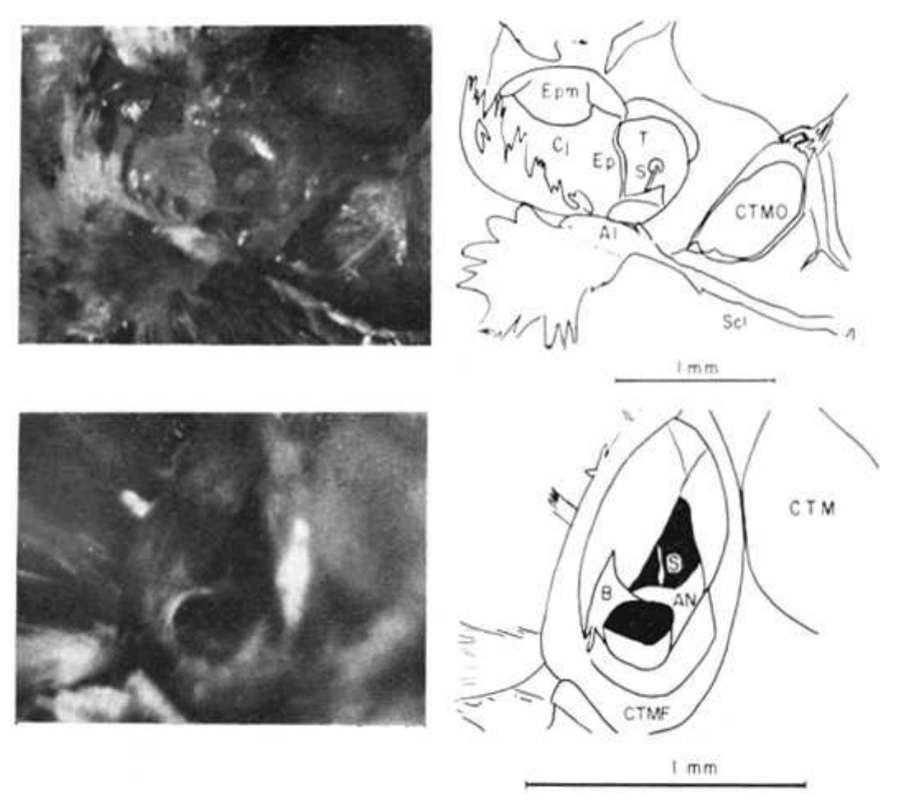
The tympanal ear places receptors at a thin membrane
A tympanum is a thin sound-responsive membrane. In noctuoid moths such as Spodoptera, paired tympanal organs lie in recesses near the hindwing bases on the metathorax, the third thoracic segment. Associated air spaces and sensory attachments couple sound to the receptor apparatus.
Adams exposed the noctuid auditory nerve near the internal cuticular support called the Bügel. A saline-filled recording electrode contacted the nerve while acoustic pulses were directed toward the tympanic recess. The preparation allowed receptor spikes to be measured without recording central neurons.
The anatomical separation matters: a peripheral response can be studied before information passes through the central nervous system. Dissection and electrode contact also impose limits, because deterioration, movement artifacts, and altered local mechanics can change the response of the prepared ear.
Adams (1971), Fig. 1, upper and lower views. Photographs and the published anatomical views of the tympanal receptor organ. DOI: 10.1085/jgp.58.5.562
Adams (1971); Nakano et al. (2022)
08
Notes:
• A tympanum is a thin sound-responsive membrane. In noctuoid moths such as Spodoptera, paired tympanal organs lie in recesses near the hindwing bases on the metathorax, the third thoracic segment. Associated air spaces and sensory attachments couple sound to the receptor apparatus.
– The tympanum receives the acoustic input and the sensory neurons supply the electrical output. Recording at the nerve separates that output from later central processing, but it does not directly measure the membrane’s displacement or the current at a receptor ending.
• Adams exposed the noctuid auditory nerve near the internal cuticular support called the Bügel. A saline-filled recording electrode contacted the nerve while acoustic pulses were directed toward the tympanic recess. The preparation allowed receptor spikes to be measured without recording central neurons.
• The anatomical separation matters: a peripheral response can be studied before information passes through the central nervous system. Dissection and electrode contact also impose limits, because deterioration, movement artifacts, and altered local mechanics can change the response of the prepared ear.
References:
Adams WB (1971). Intensity characteristics of the noctuid acoustic receptor. Journal of General Physiology 58(5): 562–579. https://doi.org/10.1085/jgp.58.5.562
Nakano R, Ito A, Tokumaru S (2022). Sustainable pest control inspired by prey–predator ultrasound interactions. Proceedings of the National Academy of Sciences 119(43): e2211007119. https://doi.org/10.1073/pnas.2211007119
Figure: Adams (1971), Fig. 1, upper and lower views. Photographs and the published anatomical views of the tympanal receptor organ. DOI: 10.1085/jgp.58.5.562
Figure source: https://doi.org/10.1085/jgp.58.5.562

Slide 9
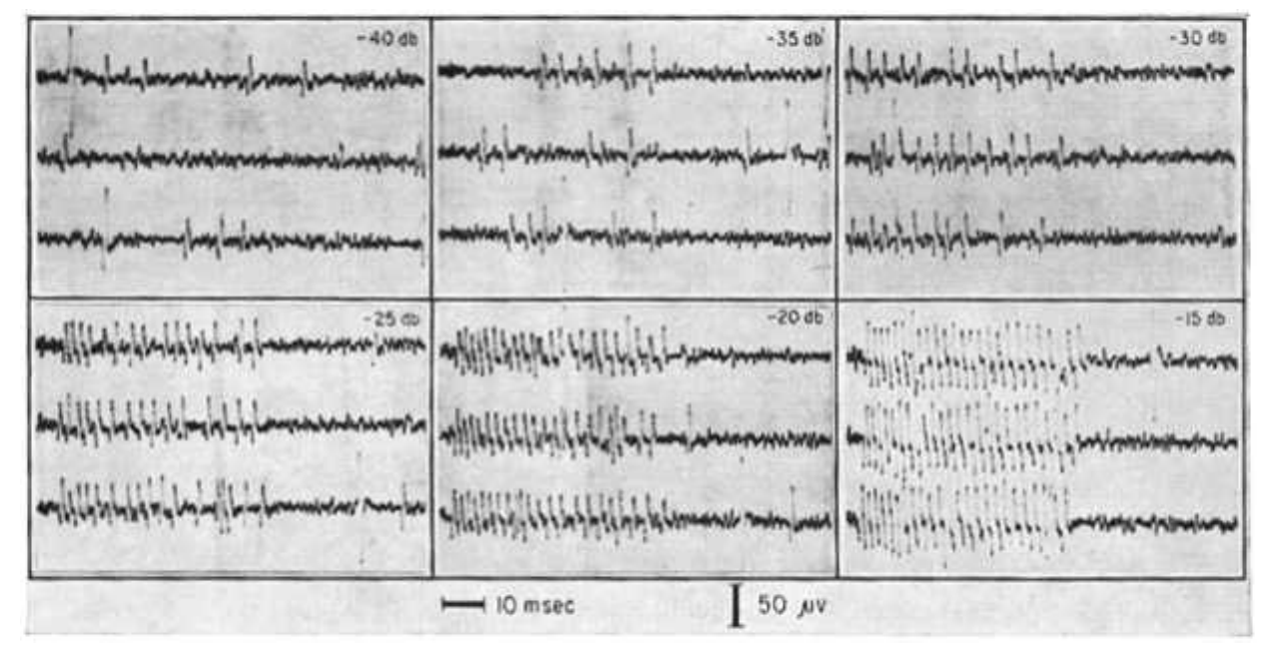
A1, A2, and B carry different peripheral information
Each noctuid ear contains two auditory receptor neurons, A1 and A2, whose axons join the tympanic nerve. A receptor neuron converts a stimulus into electrical activity; an afferent carries that activity toward the central nervous system.
A1 is the more sensitive acoustic receptor, while A2 requires sound levels roughly 20 dB or more higher in the classic preparations. The additional B fiber responds to distortion around the Bügel’s epithelial sheath rather than to the acoustic stimulation used in these experiments.
Adams separated their extracellular spikes by acoustic responsiveness and waveform size. In his recordings, A1 spikes were larger than A2 spikes, and B spikes persisted without sound. Waveform amplitude depends on electrode geometry, however, so size alone is not an interchangeable cell label across preparations.
Adams (1971), Fig. 4, all recordings. Auditory-nerve traces containing A1 spikes and larger spontaneous B-fiber spikes. DOI: 10.1085/jgp.58.5.562
Adams (1971)
09
Notes:
• Each noctuid ear contains two auditory receptor neurons, A1 and A2, whose axons join the tympanic nerve. A receptor neuron converts a stimulus into electrical activity; an afferent carries that activity toward the central nervous system.
– Two auditory neurons per ear do not mean that every spike recorded from the tympanic nerve is auditory. The B fiber supplies a distinct mechanical signal. Controlled sound presentation is therefore part of the identification procedure, alongside the extracellular waveform.
• A1 is the more sensitive acoustic receptor, while A2 requires sound levels roughly 20 dB or more higher in the classic preparations. The additional B fiber responds to distortion around the Bügel’s epithelial sheath rather than to the acoustic stimulation used in these experiments.
• Adams separated their extracellular spikes by acoustic responsiveness and waveform size. In his recordings, A1 spikes were larger than A2 spikes, and B spikes persisted without sound. Waveform amplitude depends on electrode geometry, however, so size alone is not an interchangeable cell label across preparations.
References:
Adams WB (1971). Intensity characteristics of the noctuid acoustic receptor. Journal of General Physiology 58(5): 562–579. https://doi.org/10.1085/jgp.58.5.562
Figure: Adams (1971), Fig. 4, all recordings. Auditory-nerve traces containing A1 spikes and larger spontaneous B-fiber spikes. DOI: 10.1085/jgp.58.5.562
Figure source: https://doi.org/10.1085/jgp.58.5.562

Slide 10
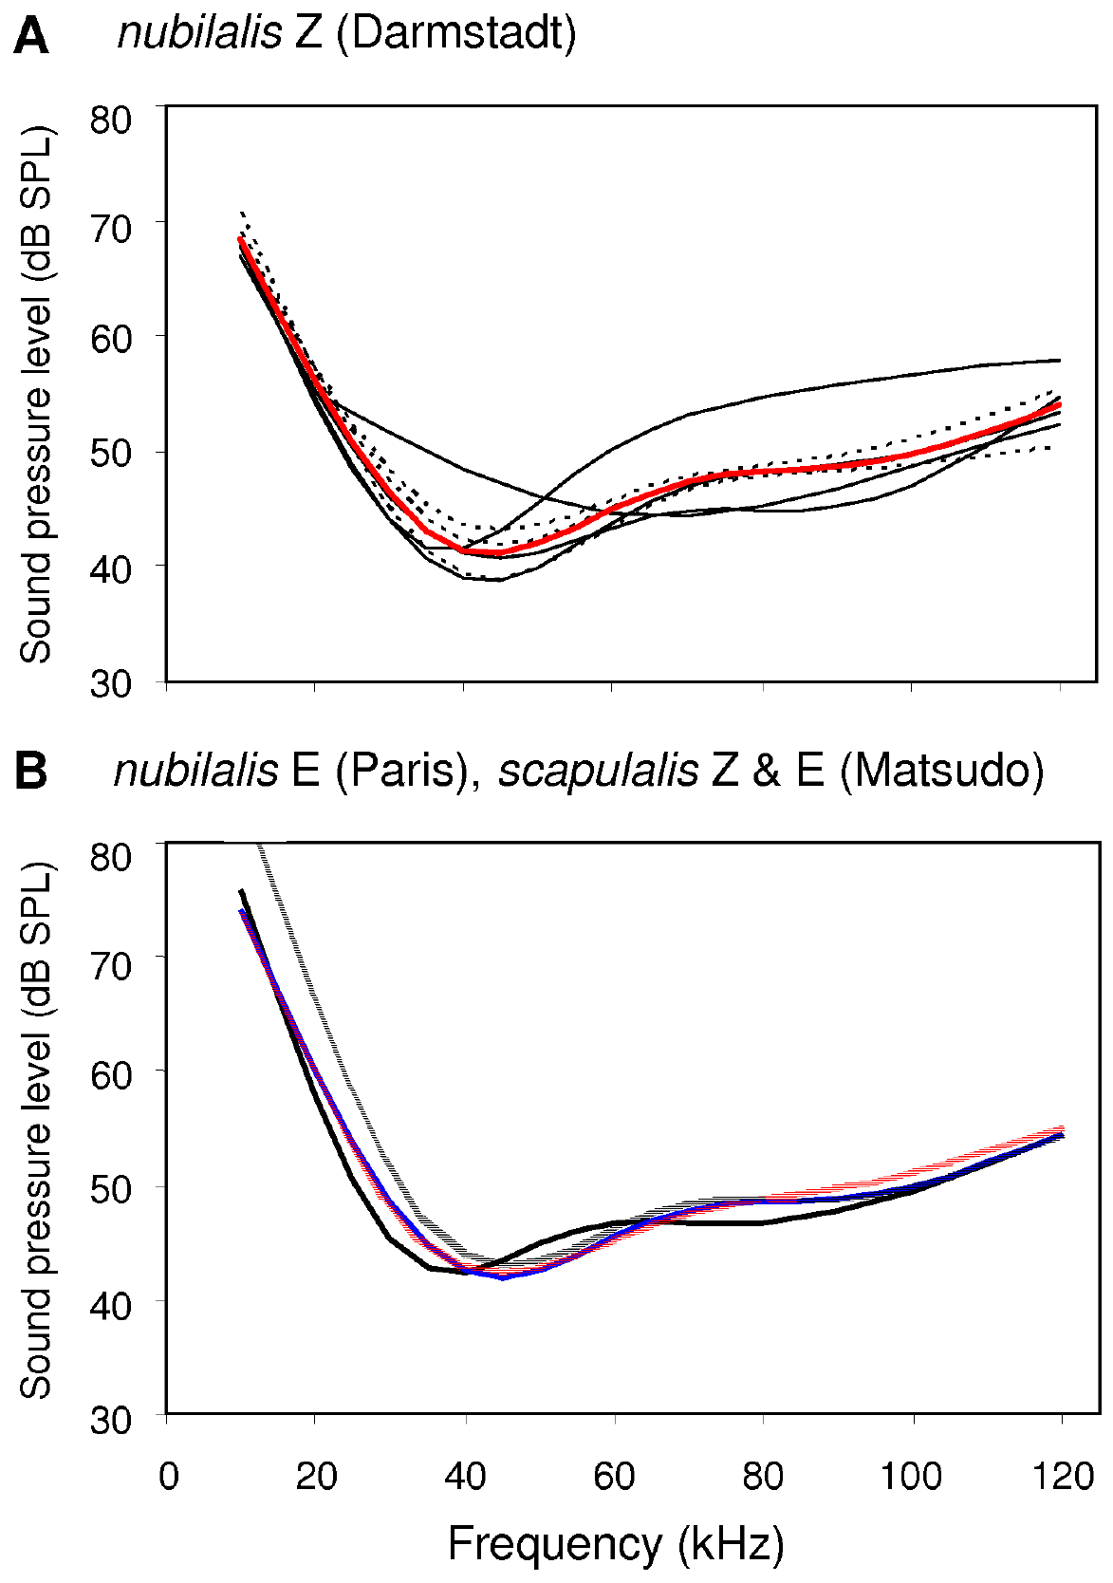
An audiogram measures frequency-dependent threshold
An audiogram gives the minimum stimulus level required to reach a specified response criterion at each frequency. A low threshold means high sensitivity. Takanashi and colleagues recorded auditory responses in Ostrinia corn-borer moths while varying pure-tone frequency and sound pressure.
In O. nubilalis, sensitivity increased above 30 kHz and declined beyond roughly 60 kHz. Individual curves from males and females occupied a similar range. The frequency axis is measured in kilohertz, whereas the threshold axis reports sound pressure level in decibels.
The curve establishes which ultrasonic inputs the peripheral system can detect under that criterion. It does not measure perceived pitch, willingness to stop flying, or the probability of escaping a bat. Those outputs require separate behavioral measurements with their own thresholds.
Takanashi et al. (2010), Fig. 6(A,B). Auditory threshold curves; A gives individuals DOI: 10.1371/journal.pone.0013144
Takanashi et al. (2010)
10
Notes:
• An audiogram gives the minimum stimulus level required to reach a specified response criterion at each frequency. A low threshold means high sensitivity. Takanashi and colleagues recorded auditory responses in Ostrinia corn-borer moths while varying pure-tone frequency and sound pressure.
– A frequency that elicits a receptor spike at low pressure is not automatically the frequency that elicits the strongest escape. Peripheral threshold, response magnitude, and motor threshold describe different parts of the sensory-to-behavior transformation.
• In O. nubilalis, sensitivity increased above 30 kHz and declined beyond roughly 60 kHz. Individual curves from males and females occupied a similar range. The frequency axis is measured in kilohertz, whereas the threshold axis reports sound pressure level in decibels.
• The curve establishes which ultrasonic inputs the peripheral system can detect under that criterion. It does not measure perceived pitch, willingness to stop flying, or the probability of escaping a bat. Those outputs require separate behavioral measurements with their own thresholds.
References:
Takanashi T, Nakano R, Surlykke A, Tatsuta H, Tabata J, Ishikawa Y, Skals N (2010). Variation in courtship ultrasounds of three Ostrinia moths with different sex pheromones. PLOS ONE 5(10): e13144. https://doi.org/10.1371/journal.pone.0013144
Figure: Takanashi et al. (2010), Fig. 6(A,B). Auditory threshold curves; A gives individuals DOI: 10.1371/journal.pone.0013144
Figure source: https://doi.org/10.1371/journal.pone.0013144

Slide 11
Similar ear tuning can serve different acoustic contexts
Takanashi and colleagues compared O. nubilalis and O. scapulalis populations with different sex-pheromone types. A pheromone is a chemical signal between members of the same species; those populations supplied a comparison of sexual signaling background and ultrasonic hearing.
Across the tested groups, the most sensitive frequency averaged 45.7 kHz and its threshold averaged 42.6 dB SPL. The investigators did not detect a clear difference in those measures between sexes or among the tested species and pheromone types.
These ears also receive ultrasonic courtship sounds. Similar peripheral tuning therefore need not imply an identical behavioral response to every ultrasound source. The experiment establishes broad sensory overlap, while the identity and context of the source require additional temporal, chemical, or behavioral information.
Takanashi et al. (2010), Fig. 6(A,B). Auditory threshold curves; B compares populations DOI: 10.1371/journal.pone.0013144
Takanashi et al. (2010)
11
Notes:
• Takanashi and colleagues compared O. nubilalis and O. scapulalis populations with different sex-pheromone types. A pheromone is a chemical signal between members of the same species; those populations supplied a comparison of sexual signaling background and ultrasonic hearing.
– The hearing measurements and courtship recordings came from the same research program, but similar audiograms are not evidence that a moth confuses every courtship signal with a predator. They establish that both kinds of signal can enter an overlapping sensory band.
• Across the tested groups, the most sensitive frequency averaged 45.7 kHz and its threshold averaged 42.6 dB SPL. The investigators did not detect a clear difference in those measures between sexes or among the tested species and pheromone types.
• These ears also receive ultrasonic courtship sounds. Similar peripheral tuning therefore need not imply an identical behavioral response to every ultrasound source. The experiment establishes broad sensory overlap, while the identity and context of the source require additional temporal, chemical, or behavioral information.
References:
Takanashi T, Nakano R, Surlykke A, Tatsuta H, Tabata J, Ishikawa Y, Skals N (2010). Variation in courtship ultrasounds of three Ostrinia moths with different sex pheromones. PLOS ONE 5(10): e13144. https://doi.org/10.1371/journal.pone.0013144
Figure: Takanashi et al. (2010), Fig. 6(A,B). Auditory threshold curves; B compares populations DOI: 10.1371/journal.pone.0013144
Figure source: https://doi.org/10.1371/journal.pone.0013144

Slide 12
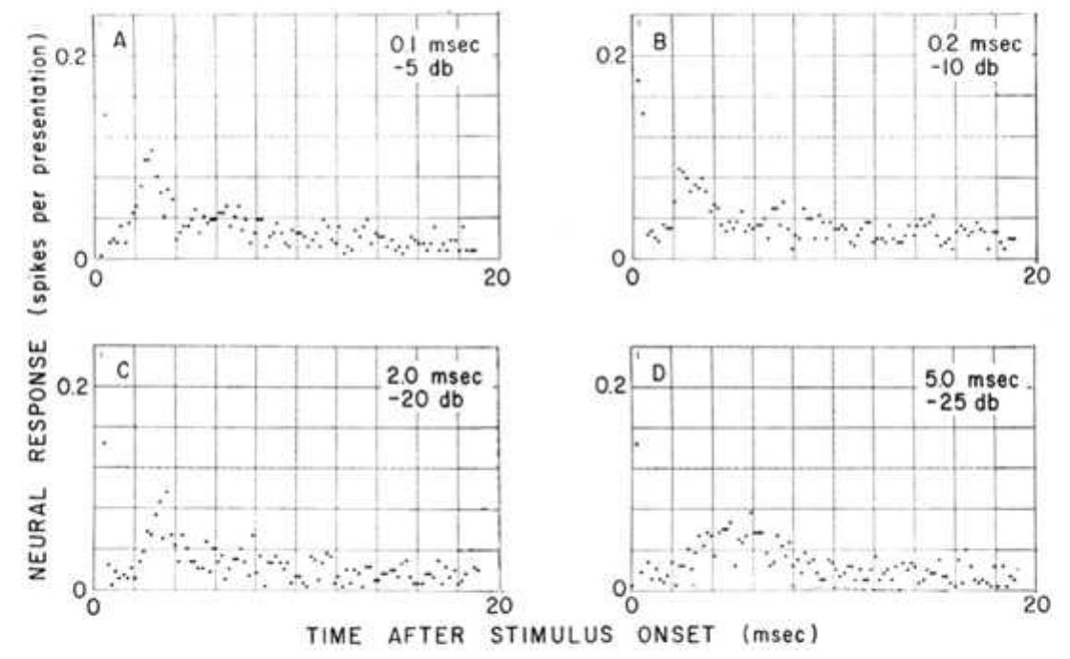
Receptor mechanics and spikes require different tests
Auditory transduction converts deformation at the sensory apparatus into electrical excitation. A generator potential is a graded receptor voltage change that precedes spike generation; its amplitude can vary even though an action potential is a discrete electrical event.
Adams measured extracellular A1 spikes as acoustic intensity and duration changed. Very brief pulses produced impulse-like spike responses, whereas longer pulses extended the response. His interpretation separated the accumulated receptor excitation from the spike output used to measure it.
These nerve recordings do not isolate a mechanotransduction channel or identify the proteins responsible for membrane excitation. Voltage-dependent spike generation and mechanical transduction are distinct processes. Assigning a particular ion channel requires measurements or interventions beyond the acoustic input–spike relationship.
Adams (1971), Fig. 2(a–d). Measured spike-response timing for stimuli of four durations. DOI: 10.1085/jgp.58.5.562
Adams (1971); Nakano et al. (2022)
12
Notes:
• Auditory transduction converts deformation at the sensory apparatus into electrical excitation. A generator potential is a graded receptor voltage change that precedes spike generation; its amplitude can vary even though an action potential is a discrete electrical event.
– A membrane conductance is a pathway for ionic current, and a graded voltage response reflects the balance of that current with the membrane’s electrical properties. The classic experiments constrain this transformation functionally, without supplying a molecular identity for its conductances.
• Adams measured extracellular A1 spikes as acoustic intensity and duration changed. Very brief pulses produced impulse-like spike responses, whereas longer pulses extended the response. His interpretation separated the accumulated receptor excitation from the spike output used to measure it.
• These nerve recordings do not isolate a mechanotransduction channel or identify the proteins responsible for membrane excitation. Voltage-dependent spike generation and mechanical transduction are distinct processes. Assigning a particular ion channel requires measurements or interventions beyond the acoustic input–spike relationship.
References:
Adams WB (1971). Intensity characteristics of the noctuid acoustic receptor. Journal of General Physiology 58(5): 562–579. https://doi.org/10.1085/jgp.58.5.562
Nakano R, Ito A, Tokumaru S (2022). Sustainable pest control inspired by prey–predator ultrasound interactions. Proceedings of the National Academy of Sciences 119(43): e2211007119. https://doi.org/10.1073/pnas.2211007119
Figure: Adams (1971), Fig. 2(a–d). Measured spike-response timing for stimuli of four durations. DOI: 10.1085/jgp.58.5.562
Figure source: https://doi.org/10.1085/jgp.58.5.562

Slide 13
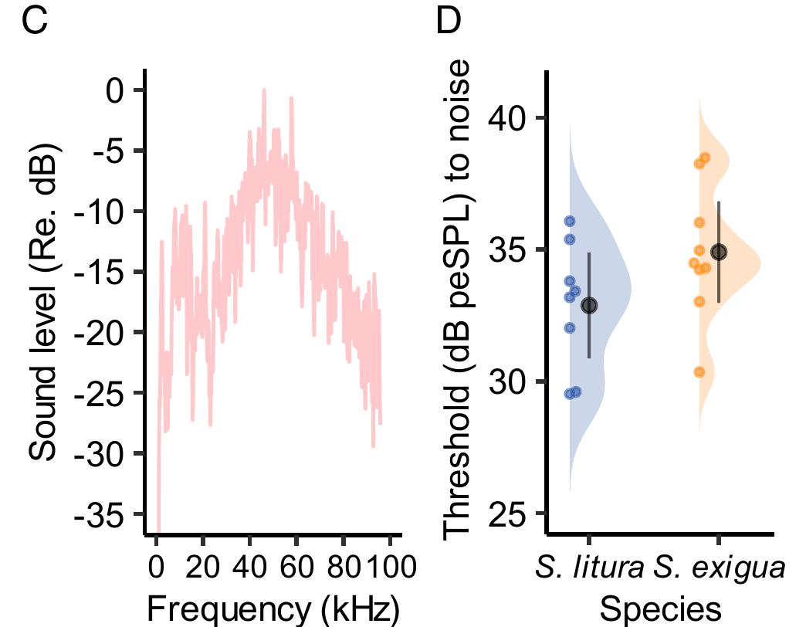
Calibration fixes the sound actually reaching the ear
An extracellular electrode records voltage outside an axon rather than its intracellular membrane potential. Nakano and colleagues contacted the auditory branch IIIN1b with a silver-wire electrode and placed a reference electrode in the metathorax of prepared Spodoptera moths.
Pure tones spanning 5–100 kHz were delivered as 20-ms pulses at two pulses per second. Stimulus frequency was selected in randomized 5-kHz steps, and amplitude was varied in 1-dB increments. A calibrated microphone close to the ear measured the acoustic input alongside the nerve response.
The threshold criterion was one or two A1 spikes. Sound-absorbing foam, vibration isolation, and shielding reduced unwanted inputs. These controls support a peripheral threshold estimate; they do not convert an extracellular waveform into a direct measurement of receptor current or central synaptic transmission.
Nakano et al. (2022), Fig. 1(C,D). Calibrated ultrasonic-noise spectrum and neural hearing thresholds. DOI: 10.1073/pnas.2211007119
Nakano et al. (2022)
13
Notes:
• An extracellular electrode records voltage outside an axon rather than its intracellular membrane potential. Nakano and colleagues contacted the auditory branch IIIN1b with a silver-wire electrode and placed a reference electrode in the metathorax of prepared Spodoptera moths.
– A loudspeaker setting is insufficient because the pressure at the animal depends on speaker response and geometry. Measuring near the ear ties the acoustic level to the physiological event, while randomized frequency presentation reduces a systematic order effect.
• Pure tones spanning 5–100 kHz were delivered as 20-ms pulses at two pulses per second. Stimulus frequency was selected in randomized 5-kHz steps, and amplitude was varied in 1-dB increments. A calibrated microphone close to the ear measured the acoustic input alongside the nerve response.
• The threshold criterion was one or two A1 spikes. Sound-absorbing foam, vibration isolation, and shielding reduced unwanted inputs. These controls support a peripheral threshold estimate; they do not convert an extracellular waveform into a direct measurement of receptor current or central synaptic transmission.
References:
Nakano R, Ito A, Tokumaru S (2022). Sustainable pest control inspired by prey–predator ultrasound interactions. Proceedings of the National Academy of Sciences 119(43): e2211007119. https://doi.org/10.1073/pnas.2211007119
Figure: Nakano et al. (2022), Fig. 1(C,D). Calibrated ultrasonic-noise spectrum and neural hearing thresholds. DOI: 10.1073/pnas.2211007119
Figure source: https://doi.org/10.1073/pnas.2211007119

Slide 14
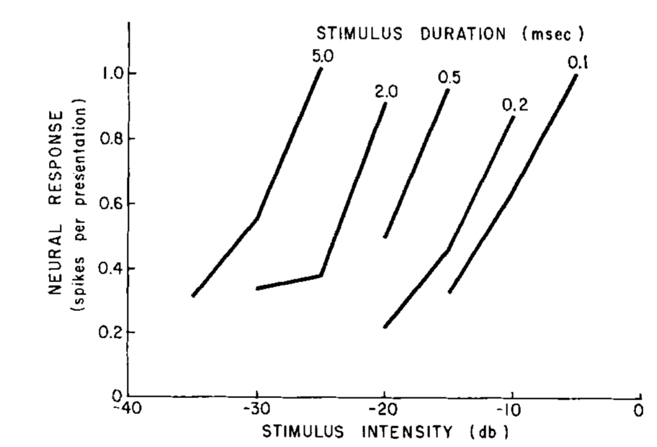
Brief-pulse efficacy depends on duration and power
Adams compared A1 responses to acoustic pulses lasting 0.1, 0.2, 2.0, and 5.0 ms. With durations near or below the receptor’s approximately 1-ms membrane time constant, the spike response resembled an impulse response rather than tracking the entire stimulus.
For a fixed response criterion, doubling duration from 0.1 to 0.2 ms required about half the stimulus power, a 3-dB decrease. Longer pulses could achieve a comparable response with less power because excitation accumulated over the pulse.
This temporal integration prevents interpreting sound level independently of duration. The relationship was measured over brief stimuli and does not imply unlimited accumulation during a long pulse train. Longer stimuli recruit adaptation and saturation that change the mapping from acoustic input to spikes.
Adams (1971), Fig. 3. Stimulus duration shifts the intensity required for a brief-pulse spike response. DOI: 10.1085/jgp.58.5.562
Adams (1971)
14
Notes:
• Adams compared A1 responses to acoustic pulses lasting 0.1, 0.2, 2.0, and 5.0 ms. With durations near or below the receptor’s approximately 1-ms membrane time constant, the spike response resembled an impulse response rather than tracking the entire stimulus.
– The membrane time constant describes how rapidly electrical excitation changes, not a fixed behavioral reaction time. A short acoustic event can be followed by a neural response whose time course is set partly by the receptor’s own dynamics.
• For a fixed response criterion, doubling duration from 0.1 to 0.2 ms required about half the stimulus power, a 3-dB decrease. Longer pulses could achieve a comparable response with less power because excitation accumulated over the pulse.
• This temporal integration prevents interpreting sound level independently of duration. The relationship was measured over brief stimuli and does not imply unlimited accumulation during a long pulse train. Longer stimuli recruit adaptation and saturation that change the mapping from acoustic input to spikes.
References:
Adams WB (1971). Intensity characteristics of the noctuid acoustic receptor. Journal of General Physiology 58(5): 562–579. https://doi.org/10.1085/jgp.58.5.562
Figure: Adams (1971), Fig. 3. Stimulus duration shifts the intensity required for a brief-pulse spike response. DOI: 10.1085/jgp.58.5.562
Figure source: https://doi.org/10.1085/jgp.58.5.562

Slide 15
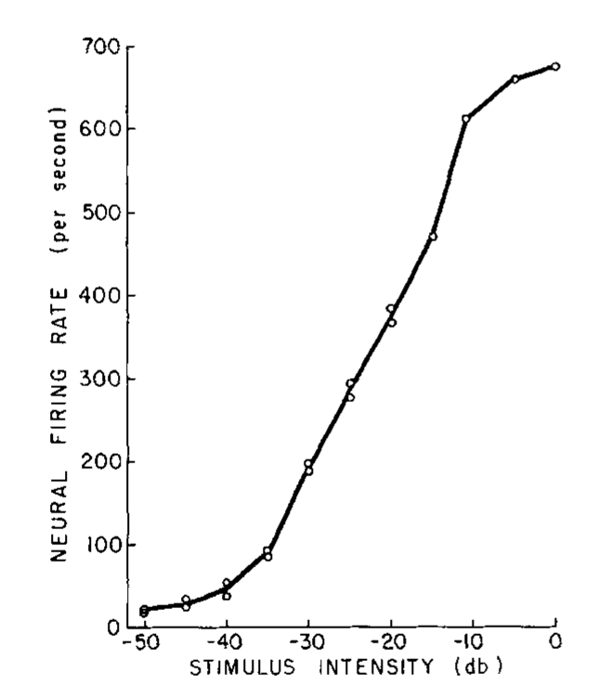
A1 firing saturates during moderate-duration tones
Adams used a 50-ms tone delivered once per second to measure A1’s intensity characteristic, the relationship between stimulus level and firing rate. He measured spikes during the final 25 ms, reducing the contribution of the onset transient.
The response rose from spontaneous activity of approximately 20–40 spikes/s to a saturated rate near 700 spikes/s. Over more than 50 dB of stimulus intensity, firing increased monotonically before reaching its upper range. Alternating ascending and descending intensity series checked stability.
Saturation limits how much additional sound intensity can be represented by rate in one receptor. The roughly 20-dB difference between A1 and A2 sensitivity provides another input at stronger levels, but the firing curve alone does not establish a dedicated escape command from either cell.
Adams (1971), Fig. 7. A1 firing approaches saturation during 50-ms tones. DOI: 10.1085/jgp.58.5.562
Adams (1971)
15
Notes:
• Adams used a 50-ms tone delivered once per second to measure A1’s intensity characteristic, the relationship between stimulus level and firing rate. He measured spikes during the final 25 ms, reducing the contribution of the onset transient.
– A constant rate late in a 50-ms tone is a selected measurement window. It should not be confused with a sustained response throughout seconds of stimulation. The low repetition rate allowed recovery between presentations and made the intensity comparison more interpretable.
• The response rose from spontaneous activity of approximately 20–40 spikes/s to a saturated rate near 700 spikes/s. Over more than 50 dB of stimulus intensity, firing increased monotonically before reaching its upper range. Alternating ascending and descending intensity series checked stability.
• Saturation limits how much additional sound intensity can be represented by rate in one receptor. The roughly 20-dB difference between A1 and A2 sensitivity provides another input at stronger levels, but the firing curve alone does not establish a dedicated escape command from either cell.
References:
Adams WB (1971). Intensity characteristics of the noctuid acoustic receptor. Journal of General Physiology 58(5): 562–579. https://doi.org/10.1085/jgp.58.5.562
Figure: Adams (1971), Fig. 7. A1 firing approaches saturation during 50-ms tones. DOI: 10.1085/jgp.58.5.562
Figure source: https://doi.org/10.1085/jgp.58.5.562

Slide 16
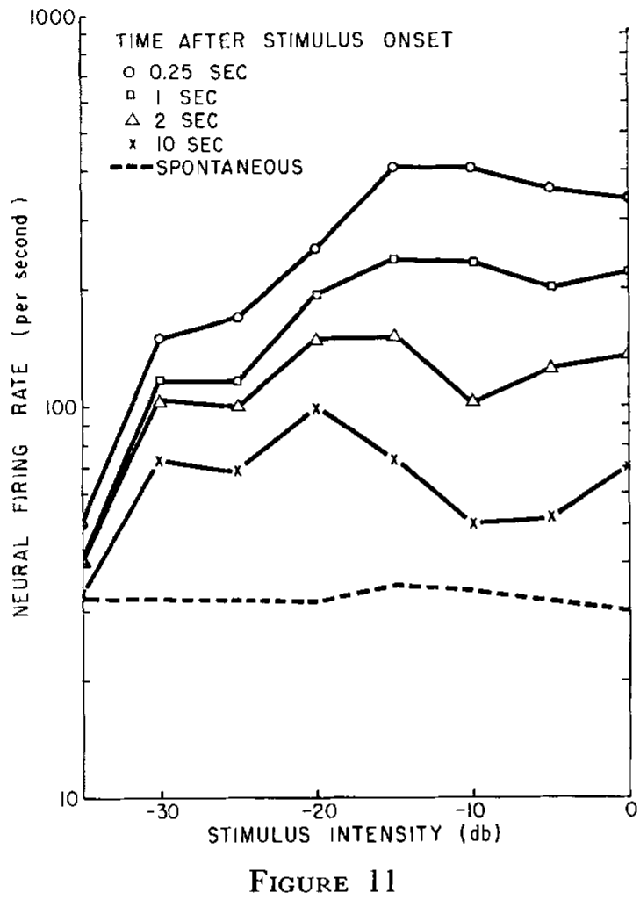
Long stimulation can reverse the intensity relationship
Sensory adaptation is a change in responsiveness during sustained or repeated input. Adams presented 10-s tones and measured how A1 discharge evolved, extending the experiment beyond the 50-ms stimulus used for the monotonic intensity curve.
Late in long stimuli, increasing acoustic intensity could produce a lower firing rate rather than a higher one. Stronger stimulation recruited greater adaptation, so the steady response no longer preserved the simple ordering between loudness and spike rate.
The result constrains a predator-distance interpretation: a low late firing rate need not indicate a quiet or distant sound source. Onset history and stimulus duration must also be considered. The extracellular experiments establish adaptation of output but do not identify its complete ionic mechanism.
Adams (1971), Fig. 11. Intensity-response relationships at different times after tone onset. DOI: 10.1085/jgp.58.5.562
Adams (1971)
16
Notes:
• Sensory adaptation is a change in responsiveness during sustained or repeated input. Adams presented 10-s tones and measured how A1 discharge evolved, extending the experiment beyond the 50-ms stimulus used for the monotonic intensity curve.
– The same receptor can encode intensity differently depending on when its response is measured. A decoder using only a late rate would receive ambiguous information unless it also retained temporal context or drew on other parts of the auditory response.
• Late in long stimuli, increasing acoustic intensity could produce a lower firing rate rather than a higher one. Stronger stimulation recruited greater adaptation, so the steady response no longer preserved the simple ordering between loudness and spike rate.
• The result constrains a predator-distance interpretation: a low late firing rate need not indicate a quiet or distant sound source. Onset history and stimulus duration must also be considered. The extracellular experiments establish adaptation of output but do not identify its complete ionic mechanism.
References:
Adams WB (1971). Intensity characteristics of the noctuid acoustic receptor. Journal of General Physiology 58(5): 562–579. https://doi.org/10.1085/jgp.58.5.562
Figure: Adams (1971), Fig. 11. Intensity-response relationships at different times after tone onset. DOI: 10.1085/jgp.58.5.562
Figure source: https://doi.org/10.1085/jgp.58.5.562

Slide 17
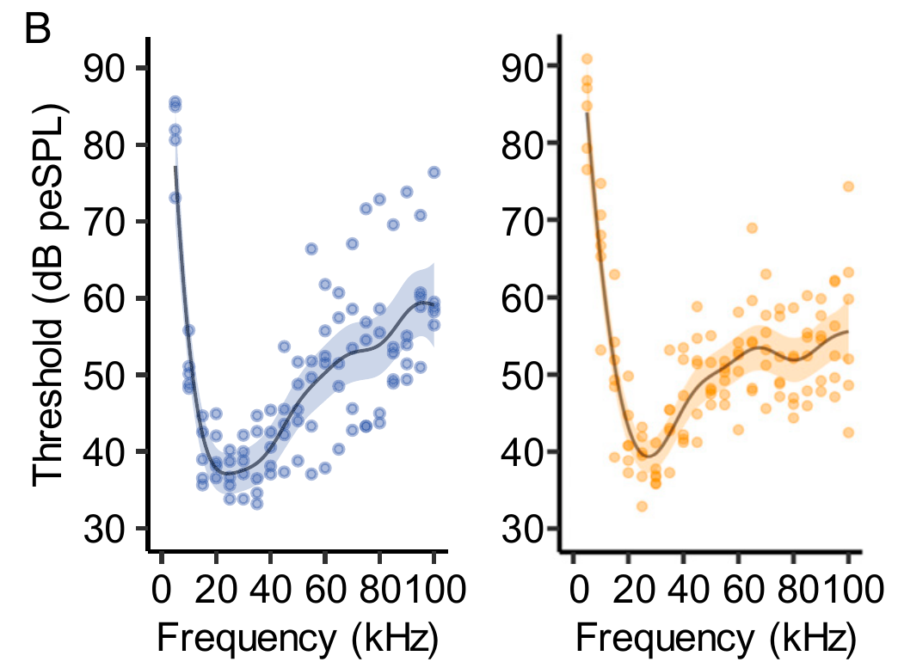
Neural detection occurs below strong escape thresholds
In S. litura, the lowest measured A1 threshold was 37.1 dB peSPL at 24.2 kHz; in S. exigua, it was 39.3 dB peSPL at 27.3 kHz. Peak-equivalent SPL expresses pulse amplitude using a calibrated equivalent sound-pressure reference.
The same study separately tested behavior with broadband ultrasonic noise covering approximately 10–70 kHz. Six-ms pulses repeated at 10 Hz induced frequent turning or flight stopping when presented above 58 dB peSPL at the moth’s position.
A receptor spike therefore cannot be equated with a strong defensive response. The threshold measurements used different stimulus bandwidths and criteria, so their numerical difference is not a precisely isolated central gain. It nevertheless separates detection from the behavioral recruitment of escape.
Nakano et al. (2022), Fig. 1(B). A1 audiograms of S. litura and S. exigua. DOI: 10.1073/pnas.2211007119
Nakano et al. (2022)
17
Notes:
• In S. litura, the lowest measured A1 threshold was 37.1 dB peSPL at 24.2 kHz; in S. exigua, it was 39.3 dB peSPL at 27.3 kHz. Peak-equivalent SPL expresses pulse amplitude using a calibrated equivalent sound-pressure reference.
– A neural criterion based on one or two spikes asks whether acoustic information reaches the nervous system. A behavioral criterion asks whether that information is sufficient, in the tested state, to alter flight. These are experimentally separate questions.
• The same study separately tested behavior with broadband ultrasonic noise covering approximately 10–70 kHz. Six-ms pulses repeated at 10 Hz induced frequent turning or flight stopping when presented above 58 dB peSPL at the moth’s position.
• A receptor spike therefore cannot be equated with a strong defensive response. The threshold measurements used different stimulus bandwidths and criteria, so their numerical difference is not a precisely isolated central gain. It nevertheless separates detection from the behavioral recruitment of escape.
References:
Nakano R, Ito A, Tokumaru S (2022). Sustainable pest control inspired by prey–predator ultrasound interactions. Proceedings of the National Academy of Sciences 119(43): e2211007119. https://doi.org/10.1073/pnas.2211007119
Figure: Nakano et al. (2022), Fig. 1(B). A1 audiograms of S. litura and S. exigua. DOI: 10.1073/pnas.2211007119
Figure source: https://doi.org/10.1073/pnas.2211007119

Slide 18
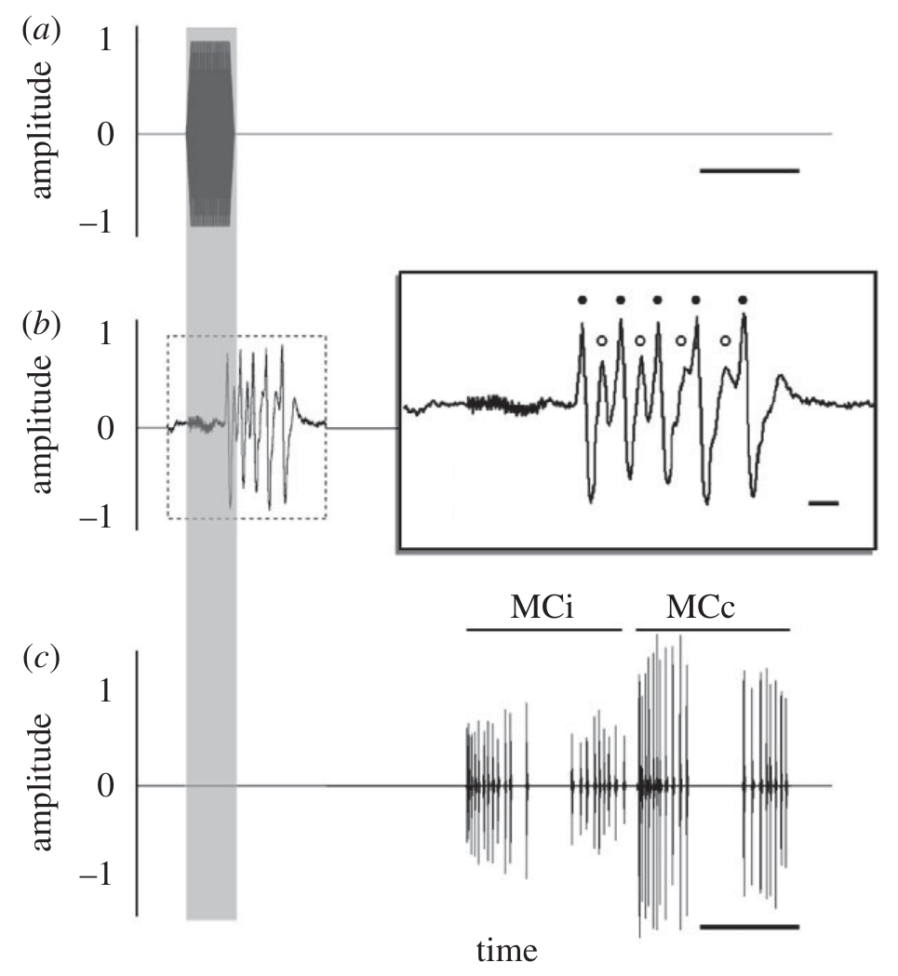
Interspike timing constrains the strength of sensory drive
An interspike period is the interval between successive action potentials in one neuron. Shorter periods correspond to faster instantaneous discharge. Ratcliffe and colleagues measured A1 and A2 bursts during bat-like pulse trains presented to the dogbane tiger moth, Cycnia tenera.
Early-attack pulses elicited averages of 5.17 A1 spikes with a minimum period of 1.84 ms; late-attack pulses elicited 2.21 A1 spikes with a minimum period of 2.45 ms. Early pulses were longer even though late trains contained more pulses.
Thus, spikes per pulse and spikes across an entire train carry different information. The historical 2.6-ms period proposed for recruiting evasive flight is a physiological criterion, not a universal command threshold for every moth species, stimulus, or defensive behavior.
Ratcliffe et al. (2011), Fig. 2(a–c). Pulse stimulus, A1/A2 spike timing, and subsequent tymbal sound. DOI: 10.1098/rspb.2010.1488
Ratcliffe et al. (2011)
18
Notes:
• An interspike period is the interval between successive action potentials in one neuron. Shorter periods correspond to faster instantaneous discharge. Ratcliffe and colleagues measured A1 and A2 bursts during bat-like pulse trains presented to the dogbane tiger moth, Cycnia tenera.
– A longer pulse can elicit more spikes per burst while a faster train delivers more bursts per second. Both quantities affect total afferent input. Separating them prevents assigning an observed behavioral change to one temporal feature when several features differ.
• Early-attack pulses elicited averages of 5.17 A1 spikes with a minimum period of 1.84 ms; late-attack pulses elicited 2.21 A1 spikes with a minimum period of 2.45 ms. Early pulses were longer even though late trains contained more pulses.
• Thus, spikes per pulse and spikes across an entire train carry different information. The historical 2.6-ms period proposed for recruiting evasive flight is a physiological criterion, not a universal command threshold for every moth species, stimulus, or defensive behavior.
References:
Ratcliffe JM, Fullard JH, Arthur BJ, Hoy RR (2011). Adaptive auditory risk assessment in the dogbane tiger moth when pursued by bats. Proceedings of the Royal Society B 278(1704): 364–370. https://doi.org/10.1098/rspb.2010.1488
Figure: Ratcliffe et al. (2011), Fig. 2(a–c). Pulse stimulus, A1/A2 spike timing, and subsequent tymbal sound. DOI: 10.1098/rspb.2010.1488
Figure source: https://doi.org/10.1098/rspb.2010.1488

Slide 19
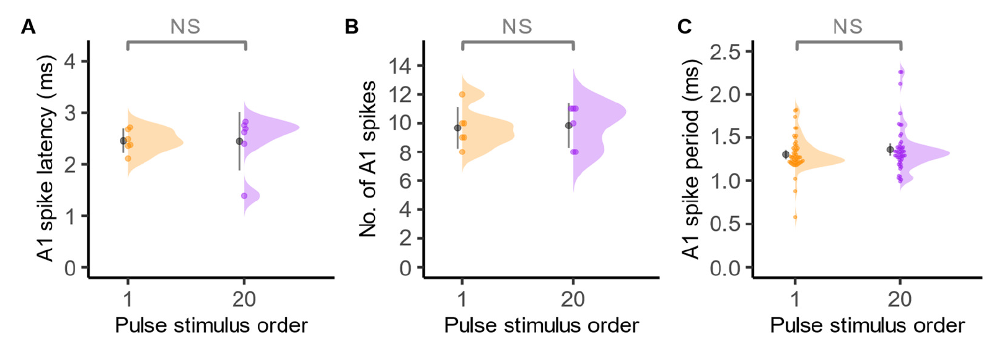
A1 can retain its response across a short pulse train
Nakano and colleagues tested whether effective repellent pulses rapidly adapted the ear. S. exigua received 6-ms broadband ultrasonic pulses at 10 Hz and 100 dB peSPL for two seconds, while A1 nerve activity was recorded.
The first and twentieth pulses produced similar first-spike latency, spike number, and interspike period. These measures test distinct aspects of the response: arrival timing, burst size, and firing speed. The published supplement reports the three measurements for the same stimulus sequence.
Nakano et al. (2022), Supplementary Fig. S2(A–C). A1 responses to first and twentieth pulses DOI: 10.1073/pnas.2211007119
The absence of a detected decline over two seconds supports sustained peripheral drive under those conditions. It does not establish that longer exposure causes no adaptation or that repeated behavioral responses cannot habituate downstream from an otherwise responsive receptor.
Nakano et al. (2022)
19
Notes:
• Nakano and colleagues tested whether effective repellent pulses rapidly adapted the ear. S. exigua received 6-ms broadband ultrasonic pulses at 10 Hz and 100 dB peSPL for two seconds, while A1 nerve activity was recorded.
– A1’s first-spike latency is measured from stimulus onset to the first recorded action potential. It includes peripheral sensory processing and recording geometry; it is not the time required for a whole moth to execute an escape maneuver.
• The first and twentieth pulses produced similar first-spike latency, spike number, and interspike period. These measures test distinct aspects of the response: arrival timing, burst size, and firing speed. The published supplement reports the three measurements for the same stimulus sequence.
• The absence of a detected decline over two seconds supports sustained peripheral drive under those conditions. It does not establish that longer exposure causes no adaptation or that repeated behavioral responses cannot habituate downstream from an otherwise responsive receptor.
References:
Nakano R, Ito A, Tokumaru S (2022). Sustainable pest control inspired by prey–predator ultrasound interactions. Proceedings of the National Academy of Sciences 119(43): e2211007119. https://doi.org/10.1073/pnas.2211007119
Figure: Nakano et al. (2022), Supplementary Fig. S2(A–C). A1 responses to first and twentieth pulses DOI: 10.1073/pnas.2211007119
Figure source: https://doi.org/10.1073/pnas.2211007119

Slide 20
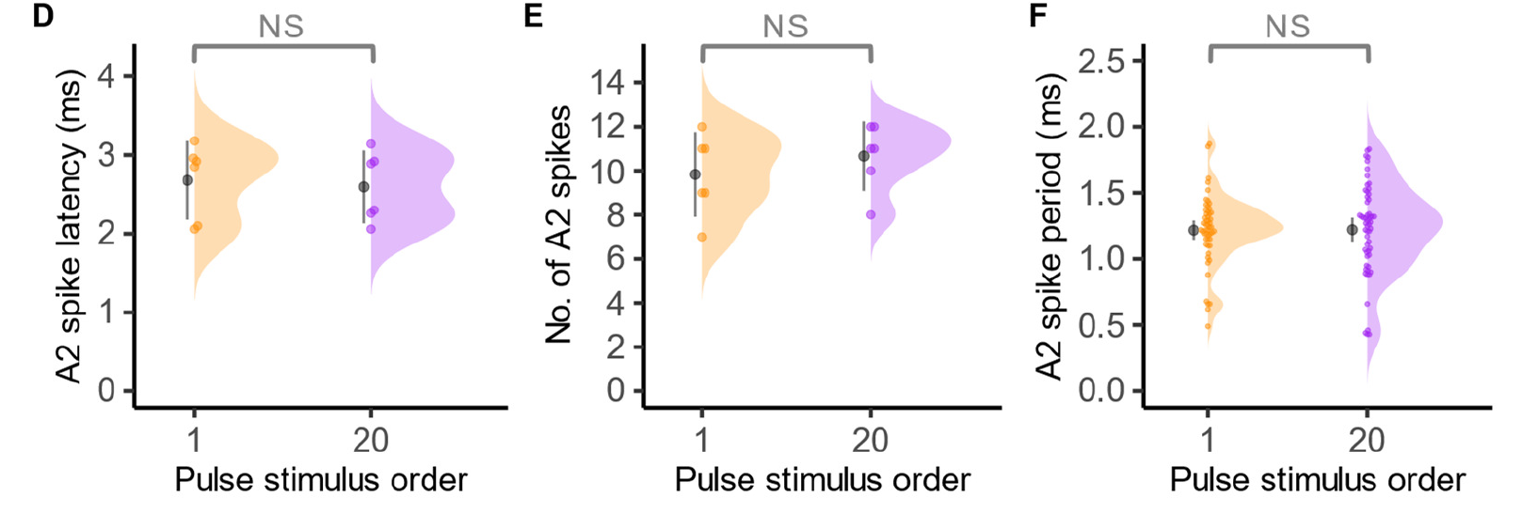
A2 also remains responsive under these pulse conditions
A2 is the less sensitive auditory receptor, but the 100-dB peSPL stimulus strongly recruits it. The S. exigua supplement measures A2 latency, spikes per pulse, and interspike period after the same first and twentieth pulses used for the A1 comparison.
The three A2 measures did not exhibit a detected reduction across the two-second train. Mean interspike periods in the corresponding Spodoptera tests remained below 2.6 ms, consistent with fast sensory bursts throughout the tested sequence.
Nakano et al. (2022), Supplementary Fig. S2(D–F). A2 responses to first and twentieth pulses DOI: 10.1073/pnas.2211007119
Stable A2 output supplies information at an intensity that activates both receptors. It does not prove that A2 is necessary for stopping flight, because neither A2 silencing nor selective activation was performed. Receptor responsiveness and causal responsibility for a motor action remain distinct.
Nakano et al. (2022)
20
Notes:
• A2 is the less sensitive auditory receptor, but the 100-dB peSPL stimulus strongly recruits it. The S. exigua supplement measures A2 latency, spikes per pulse, and interspike period after the same first and twentieth pulses used for the A1 comparison.
– The paired A1 and A2 measurements describe the peripheral input available to downstream neurons. Assigning a unique behavioral role requires an intervention that distinguishes the two inputs while preserving the animal’s other sensory and motor functions.
• The three A2 measures did not exhibit a detected reduction across the two-second train. Mean interspike periods in the corresponding Spodoptera tests remained below 2.6 ms, consistent with fast sensory bursts throughout the tested sequence.
• Stable A2 output supplies information at an intensity that activates both receptors. It does not prove that A2 is necessary for stopping flight, because neither A2 silencing nor selective activation was performed. Receptor responsiveness and causal responsibility for a motor action remain distinct.
References:
Nakano R, Ito A, Tokumaru S (2022). Sustainable pest control inspired by prey–predator ultrasound interactions. Proceedings of the National Academy of Sciences 119(43): e2211007119. https://doi.org/10.1073/pnas.2211007119
Figure: Nakano et al. (2022), Supplementary Fig. S2(D–F). A2 responses to first and twentieth pulses DOI: 10.1073/pnas.2211007119
Figure source: https://doi.org/10.1073/pnas.2211007119

Slide 21
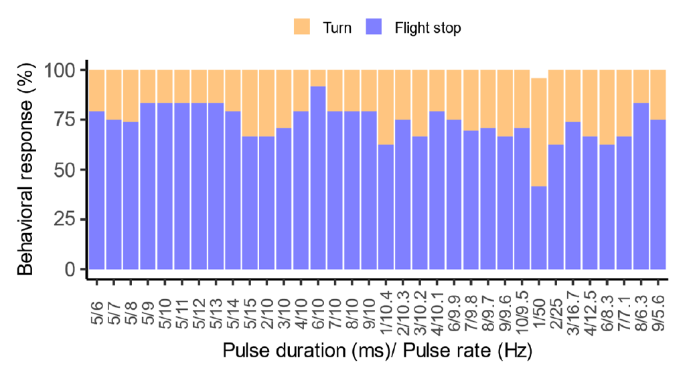
Pulse structure changes the probability of flight stopping
Nakano and colleagues refined a broad screen of pulse durations and repetition rates in tethered S. litura. Broadband ultrasound was held at a strong level while nearby temporal combinations were compared, separating stimulus timing from the spectral band.
The fine screen identified a 6-ms duration repeated at 10 Hz as most effective for cessation of wing flapping. A pulse rate of 10 Hz supplies ten pulses per second; pulse duration and the intervening silence together determine the temporal sequence reaching the ear.
Other combinations often produced turning instead of stopping. The response therefore depends on temporal structure rather than merely the presence of ultrasound. Because the moths were tethered, the experiment measures recruitment of attempted escape components rather than the success of an actual dive away from a bat.
Nakano et al. (2022), Supplementary Fig. S1. Temporal screen of turning and flight stop DOI: 10.1073/pnas.2211007119
Nakano et al. (2022)
21
Notes:
• Nakano and colleagues refined a broad screen of pulse durations and repetition rates in tethered S. litura. Broadband ultrasound was held at a strong level while nearby temporal combinations were compared, separating stimulus timing from the spectral band.
– Flight stopping and turning were scored as separate behaviors. The temporal screen does not require assuming that the most frequent acoustic pattern in nature is automatically the most effective stimulus; that ecological relationship must be tested with recorded bat calls.
• The fine screen identified a 6-ms duration repeated at 10 Hz as most effective for cessation of wing flapping. A pulse rate of 10 Hz supplies ten pulses per second; pulse duration and the intervening silence together determine the temporal sequence reaching the ear.
• Other combinations often produced turning instead of stopping. The response therefore depends on temporal structure rather than merely the presence of ultrasound. Because the moths were tethered, the experiment measures recruitment of attempted escape components rather than the success of an actual dive away from a bat.
References:
Nakano R, Ito A, Tokumaru S (2022). Sustainable pest control inspired by prey–predator ultrasound interactions. Proceedings of the National Academy of Sciences 119(43): e2211007119. https://doi.org/10.1073/pnas.2211007119
Figure: Nakano et al. (2022), Supplementary Fig. S1. Temporal screen of turning and flight stop DOI: 10.1073/pnas.2211007119
Figure source: https://doi.org/10.1073/pnas.2211007119

Slide 22
Auditory afferents terminate before the moth brain
An axon projection is the anatomical route and branching pattern of a neuron’s output process. Zhemchuzhnikov and colleagues used fluorescent tracing and confocal microscopy to distinguish the A1, A2, and B afferents in heliothine moths.
A2 arborized within the wing-bearing thoracic region, including terminal branches crossing the midline. A1 terminated in the prothoracic ganglion, the first thoracic neural center. B continued through the cervical connectives to the subesophageal ganglion beneath the brain.
None of these traced afferents projected into the brain itself. Auditory information reaching brain neurons must therefore be relayed centrally in this preparation. Anatomical branches identify candidate contact regions but do not establish synaptic signs, transmitter identity, or the behavioral effect of individual connections.
Zhemchuzhnikov et al. (2014)
22
Notes:
• An axon projection is the anatomical route and branching pattern of a neuron’s output process. Zhemchuzhnikov and colleagues used fluorescent tracing and confocal microscopy to distinguish the A1, A2, and B afferents in heliothine moths.
– A ganglion is a concentration of neuronal cell bodies and processes. The auditory axon can terminate there while another neuron carries information farther forward. That relay is distinct from extending the receptor axon itself into the brain.
• A2 arborized within the wing-bearing thoracic region, including terminal branches crossing the midline. A1 terminated in the prothoracic ganglion, the first thoracic neural center. B continued through the cervical connectives to the subesophageal ganglion beneath the brain.
• None of these traced afferents projected into the brain itself. Auditory information reaching brain neurons must therefore be relayed centrally in this preparation. Anatomical branches identify candidate contact regions but do not establish synaptic signs, transmitter identity, or the behavioral effect of individual connections.
References:
Zhemchuzhnikov MK, Pfuhl G, Berg BG (2014). Tracing and 3-dimensional representation of the primary afferents from the moth ear. Arthropod Structure & Development 43(3): 231–241. https://doi.org/10.1016/j.asd.2014.04.001

Slide 23
Ascending neurons deliver sound information to the brain
Pfuhl and colleagues combined intracellular recording with anatomical labeling in Heliothis virescens, Helicoverpa armigera, and H. assulta. Recording inside a neuron measures its electrical response, while labeling identifies the route and terminal region of that recorded cell.
Many sound-sensitive neurons ascended from the ventral nerve cord and branched densely in the anterior ventrolateral protocerebrum, a lateral region of the brain. An additional local brain interneuron had its cell body near the mushroom-body calyces and extensive processes in the same region.
These results locate a higher-order auditory target beyond the receptor afferents. They do not identify all presynaptic partners or prove a particular avoidance computation. The shared response and branching region also does not establish the transmitter released at each synapse.
Pfuhl et al. (2014)
23
Notes:
• Pfuhl and colleagues combined intracellular recording with anatomical labeling in Heliothis virescens, Helicoverpa armigera, and H. assulta. Recording inside a neuron measures its electrical response, while labeling identifies the route and terminal region of that recorded cell.
– A sensory relay and a local interneuron can both respond to sound while occupying different positions in a circuit. Morphology and physiological responsiveness together locate a pathway more securely than either measurement alone, but connection identity still requires additional evidence.
• Many sound-sensitive neurons ascended from the ventral nerve cord and branched densely in the anterior ventrolateral protocerebrum, a lateral region of the brain. An additional local brain interneuron had its cell body near the mushroom-body calyces and extensive processes in the same region.
• These results locate a higher-order auditory target beyond the receptor afferents. They do not identify all presynaptic partners or prove a particular avoidance computation. The shared response and branching region also does not establish the transmitter released at each synapse.
References:
Pfuhl G, Zhao XC, Ian E, Surlykke A, Berg BG (2014). Sound-sensitive neurons innervate the ventro-lateral protocerebrum of the heliothine moth brain. Cell and Tissue Research 355(2): 289–302. https://doi.org/10.1007/s00441-013-1749-9

Slide 24
Roeder’s central neurons transform the pulse code
Roeder distinguished receptor input from central responses using artificial pulse trains with independently varied intensity, duration, and spacing. An auditory receptor could report several changing stimulus features; a central neuron need not retain all of them.
A pulse-marker neuron reported changes in interpulse interval and train duration without providing measures of individual pulse intensity or duration. A train-marker neuron reported the duration of the pulse train, transforming the detailed peripheral burst pattern into a more selective signal.
Such response classes are defined by measured input–output properties, rather than by a complete molecular or anatomical circuit. They support feature extraction within the moth nervous system but do not prove that one marker neuron alone selects the final escape movement.
Roeder (1966)
24
Notes:
• Roeder distinguished receptor input from central responses using artificial pulse trains with independently varied intensity, duration, and spacing. An auditory receptor could report several changing stimulus features; a central neuron need not retain all of them.
– Information can be discarded as a signal passes through a network. A central response that remains stable across several intensities can still preserve pulse timing. Selectivity therefore concerns which stimulus differences alter the output, rather than the overall size of the response.
• A pulse-marker neuron reported changes in interpulse interval and train duration without providing measures of individual pulse intensity or duration. A train-marker neuron reported the duration of the pulse train, transforming the detailed peripheral burst pattern into a more selective signal.
• Such response classes are defined by measured input–output properties, rather than by a complete molecular or anatomical circuit. They support feature extraction within the moth nervous system but do not prove that one marker neuron alone selects the final escape movement.
References:
Roeder KD (1966). Auditory system of noctuid moths. Science 154(3756): 1515–1521. https://doi.org/10.1126/science.154.3756.1515

Slide 25
Bilateral excitation and inhibition can support steering
The two ears receive direction-dependent sound, and their inputs must be related to the moth’s motor state to guide a turn. Summation combines inputs; inhibition reduces a neuron’s activity in response to another input.
Roeder found central neurons that summed signals from the left and right ears and other neurons inhibited by stimulation of one ear. Wing movement also altered directional sensitivity because the wings acted as moving acoustic baffles approximately 20–40 times per second.
These observations support bilateral processing rather than two completely independent ear-to-muscle commands. Combining auditory signals with wing-state information was proposed as a steering mechanism. The identified response effects do not specify a complete motor circuit or justify naming an unmeasured inhibitory transmitter.
Roeder (1966)
25
Notes:
• The two ears receive direction-dependent sound, and their inputs must be related to the moth’s motor state to guide a turn. Summation combines inputs; inhibition reduces a neuron’s activity in response to another input.
– An inhibitory physiological effect is not itself a chemical identification. A receptor-binding assay or selective pharmacological intervention would be needed to assign a transmitter and receptor to the measured suppression. The original central recordings establish the sign of the response more directly than its molecular basis.
• Roeder found central neurons that summed signals from the left and right ears and other neurons inhibited by stimulation of one ear. Wing movement also altered directional sensitivity because the wings acted as moving acoustic baffles approximately 20–40 times per second.
• These observations support bilateral processing rather than two completely independent ear-to-muscle commands. Combining auditory signals with wing-state information was proposed as a steering mechanism. The identified response effects do not specify a complete motor circuit or justify naming an unmeasured inhibitory transmitter.
References:
Roeder KD (1966). Auditory system of noctuid moths. Science 154(3756): 1515–1521. https://doi.org/10.1126/science.154.3756.1515

Slide 26
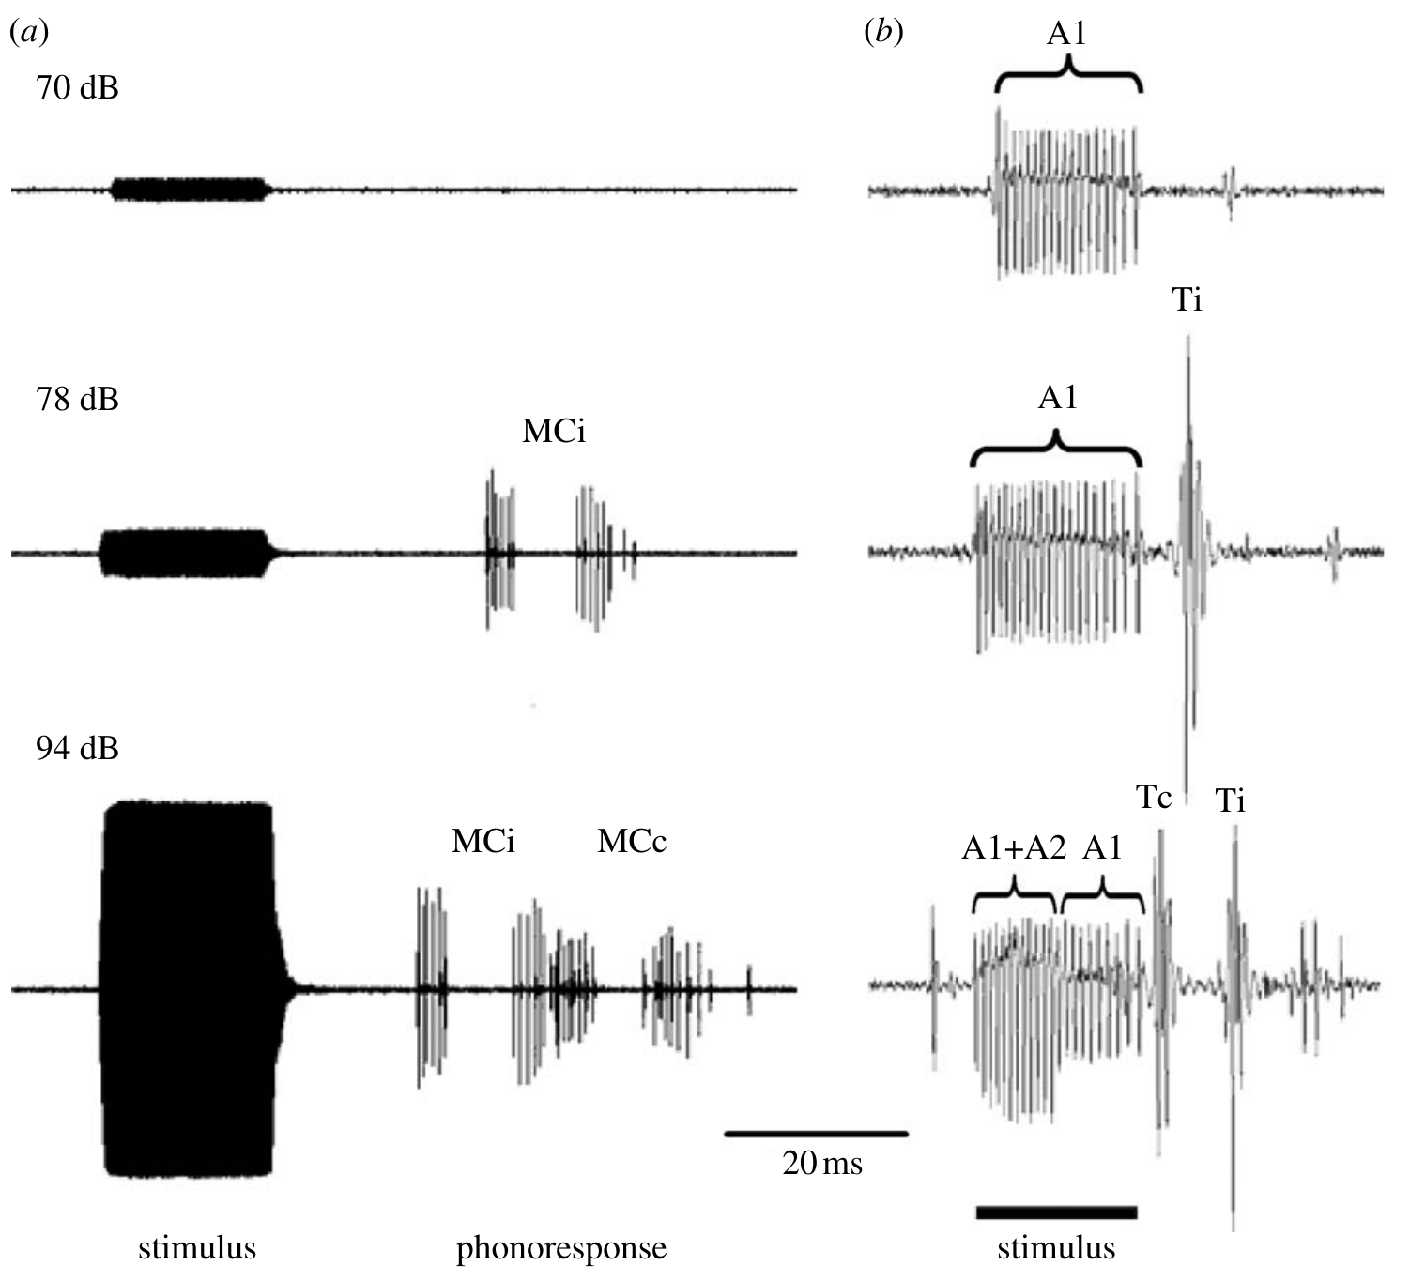
A1 activity can recruit defensive sound without A2
The dogbane tiger moth, Cycnia tenera, is chemically defended and produces ultrasonic clicks in response to threatening bat-like sound. Its phonoresponse is sound production triggered by sound, distinct from an evasive change in flight.
Ratcliffe and colleagues related auditory-cell activity to this response and found that A1 activity supplied sufficient information to initiate clicking. The less sensitive A2 cell was not necessary for initiation under their tested conditions, contrary to a strict A2-only alarm account.
Combined A1 and A2 activity was positively related to the number of clicks produced. A2 may therefore contribute to response magnitude without being an obligatory initiation switch. The result concerns defensive sound in this species and does not establish an identical division of labor for every moth’s escape flight.
Ratcliffe et al. (2009), Fig. 2(a,b). Tymbal responses occur when A1 is active without A2 recruitment. DOI: 10.1098/rsbl.2009.0079
Ratcliffe et al. (2009)
26
Notes:
• The dogbane tiger moth, Cycnia tenera, is chemically defended and produces ultrasonic clicks in response to threatening bat-like sound. Its phonoresponse is sound production triggered by sound, distinct from an evasive change in flight.
– Initiation and magnitude are separate properties of a behavior. A cell can contribute to the amount of output even when another input is sufficient to start it. The experiment also distinguishes clicking from flight, so the conclusion should retain that specific motor endpoint.
• Ratcliffe and colleagues related auditory-cell activity to this response and found that A1 activity supplied sufficient information to initiate clicking. The less sensitive A2 cell was not necessary for initiation under their tested conditions, contrary to a strict A2-only alarm account.
• Combined A1 and A2 activity was positively related to the number of clicks produced. A2 may therefore contribute to response magnitude without being an obligatory initiation switch. The result concerns defensive sound in this species and does not establish an identical division of labor for every moth’s escape flight.
References:
Ratcliffe JM, Fullard JH, Arthur BJ, Hoy RR (2009). Tiger moths and the threat of bats: decision-making based on the activity of a single sensory neuron. Biology Letters 5(3): 368–371. https://doi.org/10.1098/rsbl.2009.0079
Figure: Ratcliffe et al. (2009), Fig. 2(a,b). Tymbal responses occur when A1 is active without A2 recruitment. DOI: 10.1098/rsbl.2009.0079
Figure source: https://doi.org/10.1098/rsbl.2009.0079

Slide 27
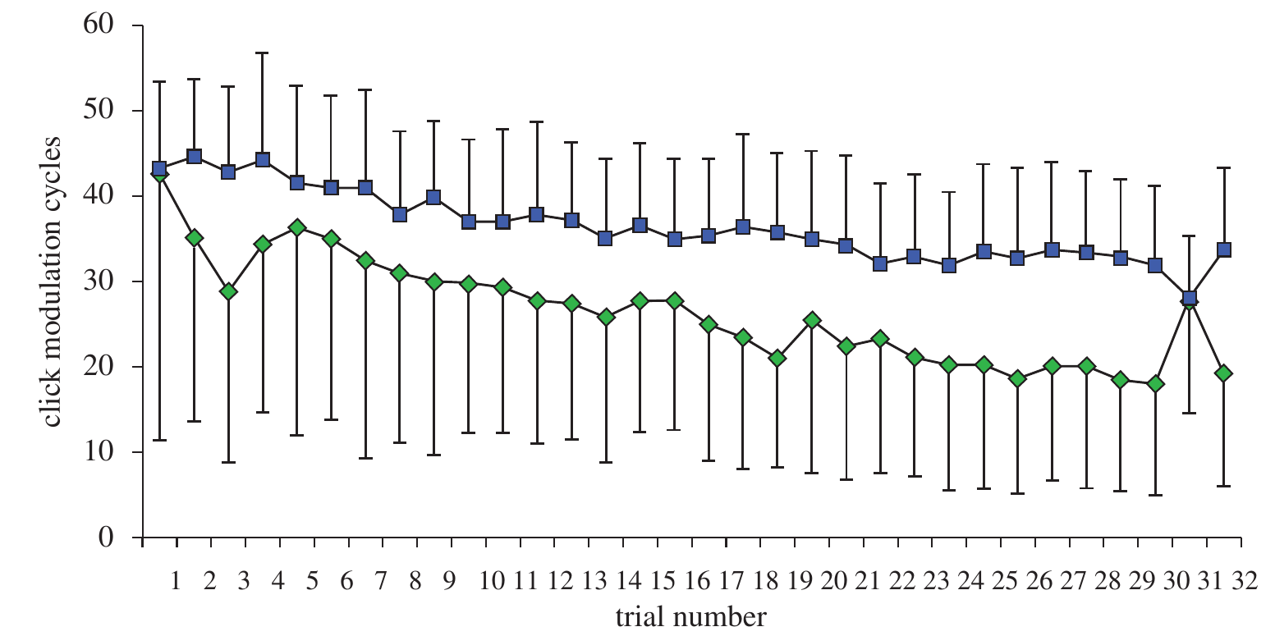
Habituation is distinguishable from sensory adaptation
Habituation is a decline in behavioral responsiveness after repeated stimulation that cannot be explained solely by sensory failure or motor exhaustion. Ratcliffe and colleagues presented C. tenera with repeated early- or late-attack acoustic trains and measured tymbal clicking.
Click production declined across 30 trials, especially for early-attack stimuli. Auditory recordings during trials 1, 30, and 32 nevertheless showed stable between-trial A1 and A2 responses, while adaptation within an individual train remained measurable.
A weakening peripheral ear response therefore did not account for the full between-trial behavioral decline. The neural and motor comparisons support processing beyond the receptors, but they do not localize the responsible synapses or identify a neuromodulator controlling the habituation.
Ratcliffe et al. (2011), Fig. 3. Behavioral clicking declines across repeated acoustic trials. DOI: 10.1098/rspb.2010.1488
Ratcliffe et al. (2011)
27
Notes:
• Habituation is a decline in behavioral responsiveness after repeated stimulation that cannot be explained solely by sensory failure or motor exhaustion. Ratcliffe and colleagues presented C. tenera with repeated early- or late-attack acoustic trains and measured tymbal clicking.
– The time scale determines which comparison is informative. A response can adapt during one train and recover before the next, while the behavioral response remains reduced across trials. That dissociation is evidence against treating adaptation and habituation as synonyms.
• Click production declined across 30 trials, especially for early-attack stimuli. Auditory recordings during trials 1, 30, and 32 nevertheless showed stable between-trial A1 and A2 responses, while adaptation within an individual train remained measurable.
• A weakening peripheral ear response therefore did not account for the full between-trial behavioral decline. The neural and motor comparisons support processing beyond the receptors, but they do not localize the responsible synapses or identify a neuromodulator controlling the habituation.
References:
Ratcliffe JM, Fullard JH, Arthur BJ, Hoy RR (2011). Adaptive auditory risk assessment in the dogbane tiger moth when pursued by bats. Proceedings of the Royal Society B 278(1704): 364–370. https://doi.org/10.1098/rspb.2010.1488
Figure: Ratcliffe et al. (2011), Fig. 3. Behavioral clicking declines across repeated acoustic trials. DOI: 10.1098/rspb.2010.1488
Figure source: https://doi.org/10.1098/rspb.2010.1488

Slide 28
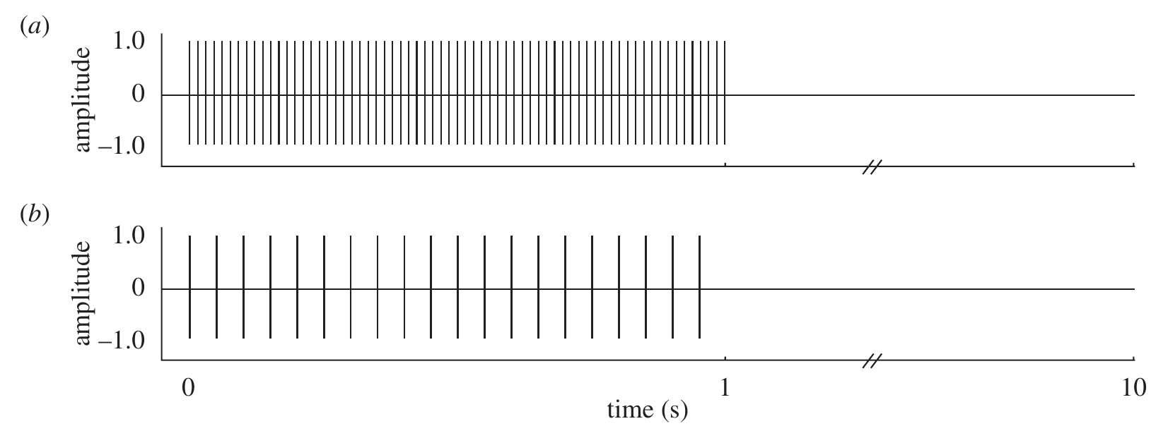
Equal sound energy does not imply equal risk coding
Ratcliffe and colleagues compared early-attack trains containing twenty 5-ms pulses with late-attack trains containing sixty-seven 1.5-ms pulses. Both were one-second trains at 50 kHz and 95 dB peSPL, with approximately equal total sound duration and duty cycle.
Duty cycle is the proportion of time occupied by acoustic emission. Holding it approximately constant balanced long, infrequent pulses against short, frequent pulses. The two groups initially produced similar click responses even though individual pulses recruited different A1 and A2 bursts.
After repetition, early-attack responses declined more strongly. The temporal arrangement therefore affected subsequent behavioral responsiveness beyond the initial total acoustic exposure. This design does not isolate pulse rate from pulse duration completely, because those two variables were deliberately traded against one another.
Ratcliffe et al. (2011), Fig. 1(a,b). Late- and early-attack trains have different temporal organization. DOI: 10.1098/rspb.2010.1488
Ratcliffe et al. (2011)
28
Notes:
• Ratcliffe and colleagues compared early-attack trains containing twenty 5-ms pulses with late-attack trains containing sixty-seven 1.5-ms pulses. Both were one-second trains at 50 kHz and 95 dB peSPL, with approximately equal total sound duration and duty cycle.
– The late-attack stimulus contained more pulses but each was shorter. That balance makes an equal initial response compatible with different peripheral patterns. It also explains why the habituation result should be attributed to the tested temporal configuration rather than to a uniquely isolated rate variable.
• Duty cycle is the proportion of time occupied by acoustic emission. Holding it approximately constant balanced long, infrequent pulses against short, frequent pulses. The two groups initially produced similar click responses even though individual pulses recruited different A1 and A2 bursts.
• After repetition, early-attack responses declined more strongly. The temporal arrangement therefore affected subsequent behavioral responsiveness beyond the initial total acoustic exposure. This design does not isolate pulse rate from pulse duration completely, because those two variables were deliberately traded against one another.
References:
Ratcliffe JM, Fullard JH, Arthur BJ, Hoy RR (2011). Adaptive auditory risk assessment in the dogbane tiger moth when pursued by bats. Proceedings of the Royal Society B 278(1704): 364–370. https://doi.org/10.1098/rspb.2010.1488
Figure: Ratcliffe et al. (2011), Fig. 1(a,b). Late- and early-attack trains have different temporal organization. DOI: 10.1098/rspb.2010.1488
Figure source: https://doi.org/10.1098/rspb.2010.1488

Slide 29
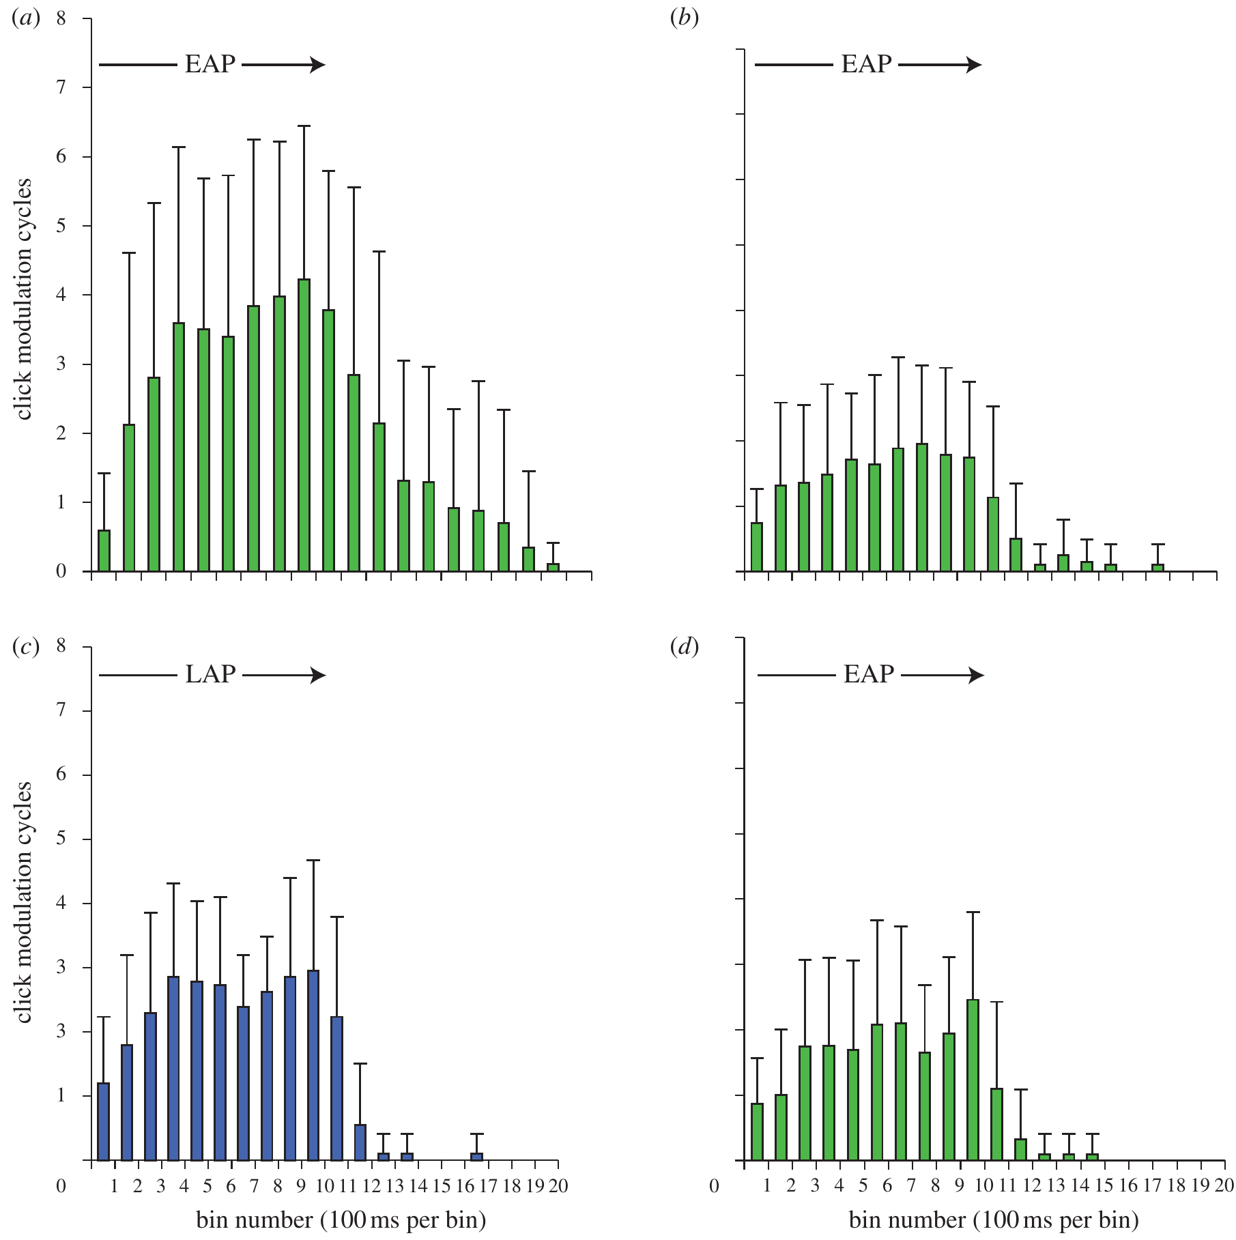
Switching attack patterns reveals discrimination
Following thirty presentations of one train type, C. tenera received the other type on trial 31 and the original type again on trial 32. This sequence tested stimulus generalization, whether reduced responsiveness transferred from one acoustic pattern to another.
Moths habituated to early-attack calls increased clicking when late-attack calls were substituted. Moths habituated to late-attack calls decreased clicking when early-attack calls were substituted. Returning to the original pattern did not produce a clear recovery of its initial response.
The asymmetric change supports discrimination between the two risk-associated patterns and argues against simple muscle fatigue. Failure to recover to the original pattern also means that a dishabituation-only test would miss this distinction. The experiment establishes behavioral discrimination without assigning conscious risk estimation.
Ratcliffe et al. (2011), Fig. 4(a–d). Click timing before habituation, after habituation, after a stimulus switch, and after return. DOI: 10.1098/rspb.2010.1488
Ratcliffe et al. (2011)
29
Notes:
• Following thirty presentations of one train type, C. tenera received the other type on trial 31 and the original type again on trial 32. This sequence tested stimulus generalization, whether reduced responsiveness transferred from one acoustic pattern to another.
– Generalization and dishabituation ask different questions. A response to a new pattern can differ even when presentation of that pattern does not restore responding to the old one. The direction of the change reflects the specific acoustic sequence rather than a nonspecific novelty response.
• Moths habituated to early-attack calls increased clicking when late-attack calls were substituted. Moths habituated to late-attack calls decreased clicking when early-attack calls were substituted. Returning to the original pattern did not produce a clear recovery of its initial response.
• The asymmetric change supports discrimination between the two risk-associated patterns and argues against simple muscle fatigue. Failure to recover to the original pattern also means that a dishabituation-only test would miss this distinction. The experiment establishes behavioral discrimination without assigning conscious risk estimation.
References:
Ratcliffe JM, Fullard JH, Arthur BJ, Hoy RR (2011). Adaptive auditory risk assessment in the dogbane tiger moth when pursued by bats. Proceedings of the Royal Society B 278(1704): 364–370. https://doi.org/10.1098/rspb.2010.1488
Figure: Ratcliffe et al. (2011), Fig. 4(a–d). Click timing before habituation, after habituation, after a stimulus switch, and after return. DOI: 10.1098/rspb.2010.1488
Figure source: https://doi.org/10.1098/rspb.2010.1488

Slide 30
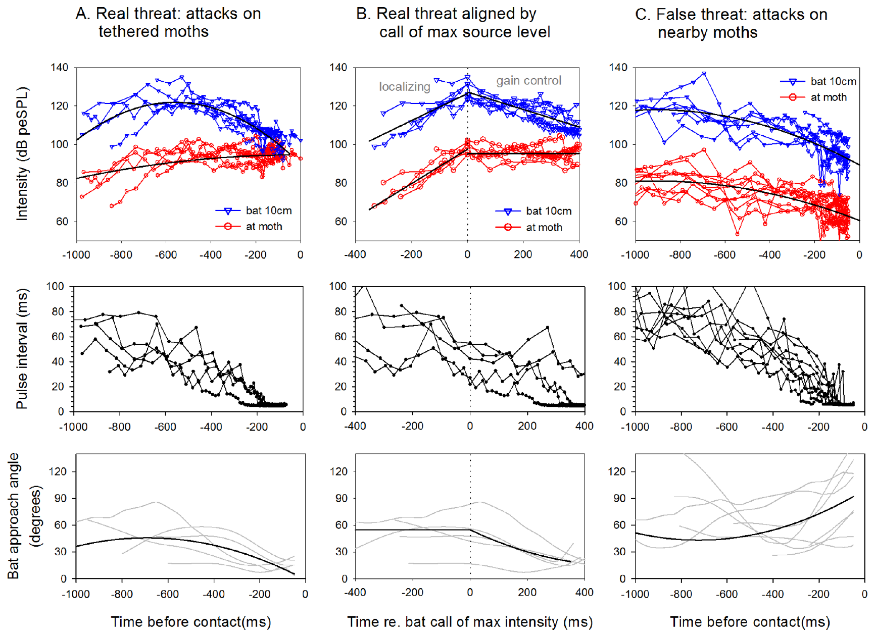
A targeted moth hears a different acoustic history
Corcoran and colleagues recorded free-flying Myotis bats near tethered moths with synchronized ultrasound and three infrared cameras. A real threat was an attack on the focal moth; a false threat was an attack on a neighboring insect.
During real attacks, sound at the focal moth generally increased as the bat localized it. When the bat reduced emission level through acoustic gain control, received level could remain near a plateau averaging 95.3 dB peSPL. During false threats, received level instead tended to decline.
Thus, received intensity is influenced by beam aim and the bat’s own level adjustment as well as distance. The reconstructed source level was estimated in the moth’s direction, not necessarily along the bat’s loudest acoustic axis. Acoustic history can distinguish targeting without supplying a perfect distance meter.
Corcoran et al. (2013), Fig. 5(A–C). Received level and trajectory during threats DOI: 10.1371/journal.pone.0063609
Corcoran et al. (2013)
30
Notes:
• Corcoran and colleagues recorded free-flying Myotis bats near tethered moths with synchronized ultrasound and three infrared cameras. A real threat was an attack on the focal moth; a false threat was an attack on a neighboring insect.
– Gain control is the bat’s adjustment of emitted sound level during approach. A closer bat can emit a weaker call while the pressure reaching its target stays relatively stable. The field measurements therefore reject a simple one-to-one mapping between received level and distance.
• During real attacks, sound at the focal moth generally increased as the bat localized it. When the bat reduced emission level through acoustic gain control, received level could remain near a plateau averaging 95.3 dB peSPL. During false threats, received level instead tended to decline.
• Thus, received intensity is influenced by beam aim and the bat’s own level adjustment as well as distance. The reconstructed source level was estimated in the moth’s direction, not necessarily along the bat’s loudest acoustic axis. Acoustic history can distinguish targeting without supplying a perfect distance meter.
References:
Corcoran AJ, Wagner RD, Conner WE (2013). Optimal predator risk assessment by the sonar-jamming arctiine moth Bertholdia trigona. PLOS ONE 8(5): e63609. https://doi.org/10.1371/journal.pone.0063609
Figure: Corcoran et al. (2013), Fig. 5(A–C). Received level and trajectory during threats DOI: 10.1371/journal.pone.0063609
Figure source: https://doi.org/10.1371/journal.pone.0063609

Slide 31
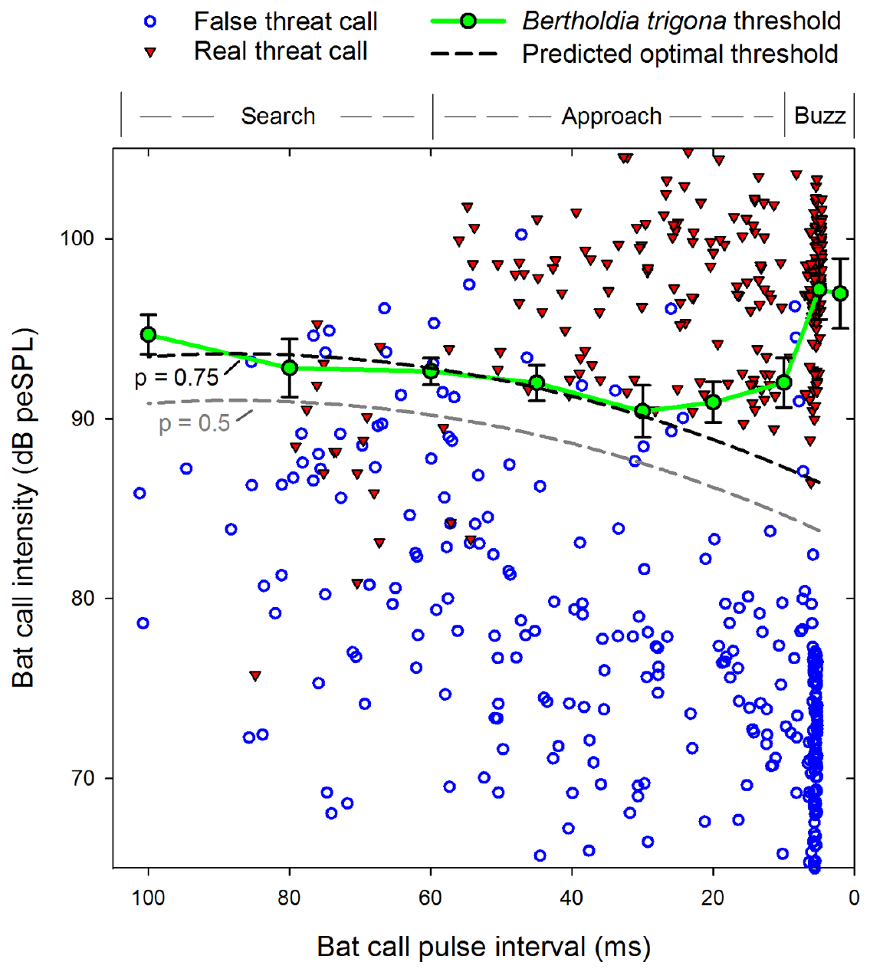
Clicking thresholds combine intensity with pulse interval
Bertholdia trigona produces defensive ultrasound. In a sound chamber, Corcoran and colleagues varied pulse interval from 4 to 100 ms while gradually increasing the level of 2-ms, 40-kHz pulses and measuring the first moth click.
The lowest clicking thresholds occurred at intervals of 20–30 ms, corresponding to late approach. Thresholds were higher for search-like intervals and very short buzz-like intervals. A fixed received level therefore does not evoke the same response across all temporal patterns.
Laboratory thresholds broadly matched a field-derived discrimination boundary at intervals of 35–100 ms, but matched poorly at 20 ms and below. The comparison supports joint acoustic cue use while exposing a limit: similarity to an optimal boundary does not prove that the moth implements the researchers’ mathematical classifier.
Corcoran et al. (2013), Fig. 4. Measured thresholds and field threat calls DOI: 10.1371/journal.pone.0063609
Corcoran et al. (2013)
31
Notes:
• Bertholdia trigona produces defensive ultrasound. In a sound chamber, Corcoran and colleagues varied pulse interval from 4 to 100 ms while gradually increasing the level of 2-ms, 40-kHz pulses and measuring the first moth click.
– The published figure includes a fitted decision boundary as well as actual field calls and measured moth thresholds. That boundary belongs to the original paper. Its fit is a comparison of behavior with a prediction, rather than an identified neural circuit.
• The lowest clicking thresholds occurred at intervals of 20–30 ms, corresponding to late approach. Thresholds were higher for search-like intervals and very short buzz-like intervals. A fixed received level therefore does not evoke the same response across all temporal patterns.
• Laboratory thresholds broadly matched a field-derived discrimination boundary at intervals of 35–100 ms, but matched poorly at 20 ms and below. The comparison supports joint acoustic cue use while exposing a limit: similarity to an optimal boundary does not prove that the moth implements the researchers’ mathematical classifier.
References:
Corcoran AJ, Wagner RD, Conner WE (2013). Optimal predator risk assessment by the sonar-jamming arctiine moth Bertholdia trigona. PLOS ONE 8(5): e63609. https://doi.org/10.1371/journal.pone.0063609
Figure: Corcoran et al. (2013), Fig. 4. Measured thresholds and field threat calls DOI: 10.1371/journal.pone.0063609
Figure source: https://doi.org/10.1371/journal.pone.0063609

Slide 32
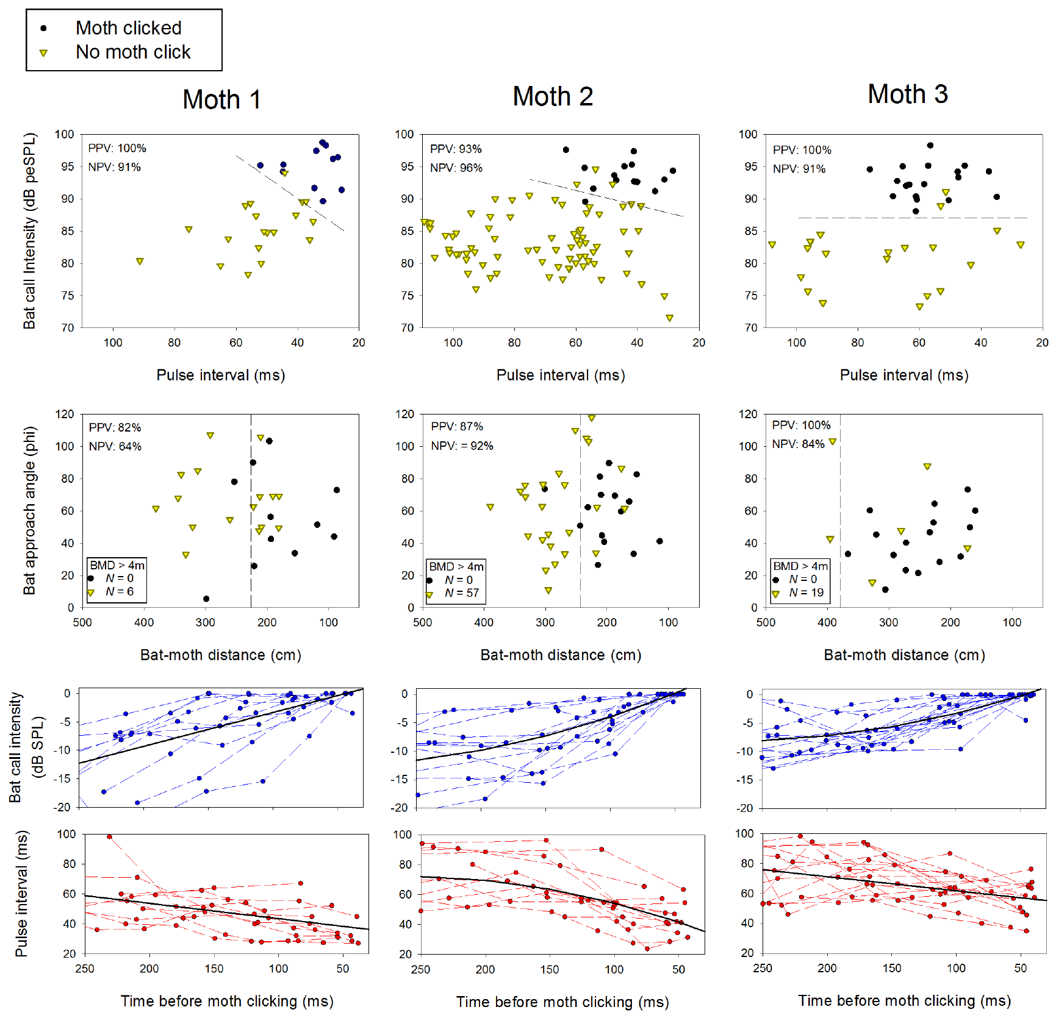
Field clicking tracks acoustic cues better than proximity
The field experiment also recorded B. trigona itself while bats passed nearby. The authors compared bat passes that did and did not elicit clicks, using both received acoustic features and reconstructed bat–moth geometry.
Clicking usually followed calls at intervals of 25–60 ms, spanning early to middle approach. Received intensity was informative for all tested moths; pulse interval contributed for some. In the 250 ms before clicking, sound level typically increased while interval shortened.
Acoustic features classified approximately 98% of clicking and 93% of non-clicking interactions correctly, better than the corresponding flight-geometry classifications. These values describe fit to this field dataset, not an independently validated neural decoder or a universal behavioral prediction across moths and bats.
Corcoran et al. (2013), Fig. 6. Acoustic and spatial predictors of clicking DOI: 10.1371/journal.pone.0063609
Corcoran et al. (2013)
32
Notes:
• The field experiment also recorded B. trigona itself while bats passed nearby. The authors compared bat passes that did and did not elicit clicks, using both received acoustic features and reconstructed bat–moth geometry.
– A nearby bat is not necessarily targeting the moth. Beam aim and the changing call sequence can supply more relevant information than proximity alone. The analysis relates measured features to clicking, while leaving the central computation that combines them unresolved.
• Clicking usually followed calls at intervals of 25–60 ms, spanning early to middle approach. Received intensity was informative for all tested moths; pulse interval contributed for some. In the 250 ms before clicking, sound level typically increased while interval shortened.
• Acoustic features classified approximately 98% of clicking and 93% of non-clicking interactions correctly, better than the corresponding flight-geometry classifications. These values describe fit to this field dataset, not an independently validated neural decoder or a universal behavioral prediction across moths and bats.
References:
Corcoran AJ, Wagner RD, Conner WE (2013). Optimal predator risk assessment by the sonar-jamming arctiine moth Bertholdia trigona. PLOS ONE 8(5): e63609. https://doi.org/10.1371/journal.pone.0063609
Figure: Corcoran et al. (2013), Fig. 6. Acoustic and spatial predictors of clicking DOI: 10.1371/journal.pone.0063609
Figure source: https://doi.org/10.1371/journal.pone.0063609

Slide 33
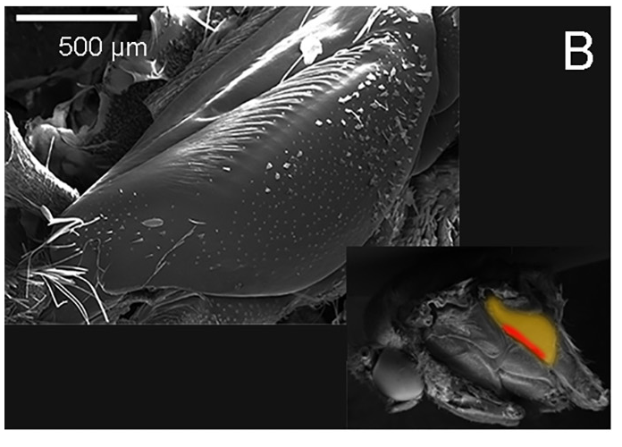
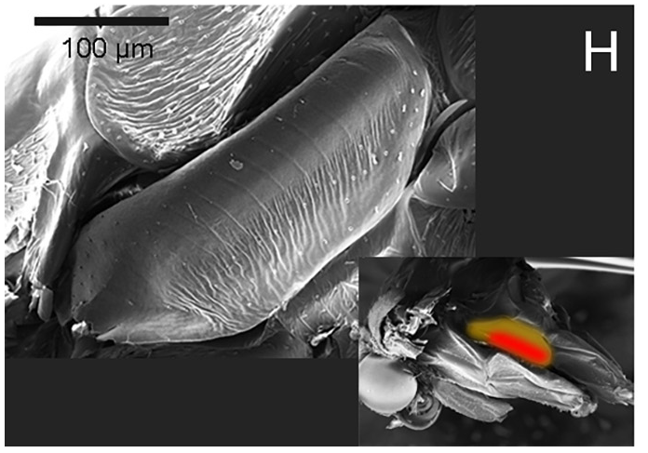
Tymbals produce clicks through buckling and relaxation
A tymbal is a sound-producing cuticular structure, distinct from the sound-receiving tympanum. Tiger moths can buckle and release their tymbals to produce groups of broadband clicks during activation and relaxation.
Dowdy and Conner compared Pygarctia roseicapitis and Cisthene martini. Microscopy exposed the tymbal structures, and acoustic recordings measured their click cycles. Both species produced sound during laboratory bat-call playback and during natural encounters with hunting bats.
The structures and recordings connect a motor-driven cuticular movement with acoustic output. They do not identify the entire auditory-to-tymbal neural pathway. Sound production must also be tested functionally, because the presence of a clicking organ does not establish whether its signals warn, jam, or merely startle a predator.
Dowdy & Conner (2016), Fig. 1(B). P. roseicapitis tymbal. DOI: 10.1371/journal.pone.0152981
Dowdy & Conner (2016), Fig. 1(H). C. martini tymbal. DOI: 10.1371/journal.pone.0152981
Dowdy & Conner (2016)
33
Notes:
• A tymbal is a sound-producing cuticular structure, distinct from the sound-receiving tympanum. Tiger moths can buckle and release their tymbals to produce groups of broadband clicks during activation and relaxation.
– The tympanum and tymbal lie at opposite ends of the defensive sequence: the ear receives acoustic evidence, whereas the tymbal emits a response. An anatomical similarity in terminology does not mean the two membranes perform the same biological operation.
• Dowdy and Conner compared Pygarctia roseicapitis and Cisthene martini. Microscopy exposed the tymbal structures, and acoustic recordings measured their click cycles. Both species produced sound during laboratory bat-call playback and during natural encounters with hunting bats.
• The structures and recordings connect a motor-driven cuticular movement with acoustic output. They do not identify the entire auditory-to-tymbal neural pathway. Sound production must also be tested functionally, because the presence of a clicking organ does not establish whether its signals warn, jam, or merely startle a predator.
References:
Dowdy NJ, Conner WE (2016). Acoustic aposematism and evasive action in select chemically defended arctiine (Lepidoptera: Erebidae) species: Nonchalant or not? PLOS ONE 11(4): e0152981. https://doi.org/10.1371/journal.pone.0152981
Figure: Dowdy & Conner (2016), Fig. 1(B). P. roseicapitis tymbal. DOI: 10.1371/journal.pone.0152981
Figure source: https://doi.org/10.1371/journal.pone.0152981
Figure: Dowdy & Conner (2016), Fig. 1(H). C. martini tymbal. DOI: 10.1371/journal.pone.0152981
Figure source: https://doi.org/10.1371/journal.pone.0152981

Slide 34
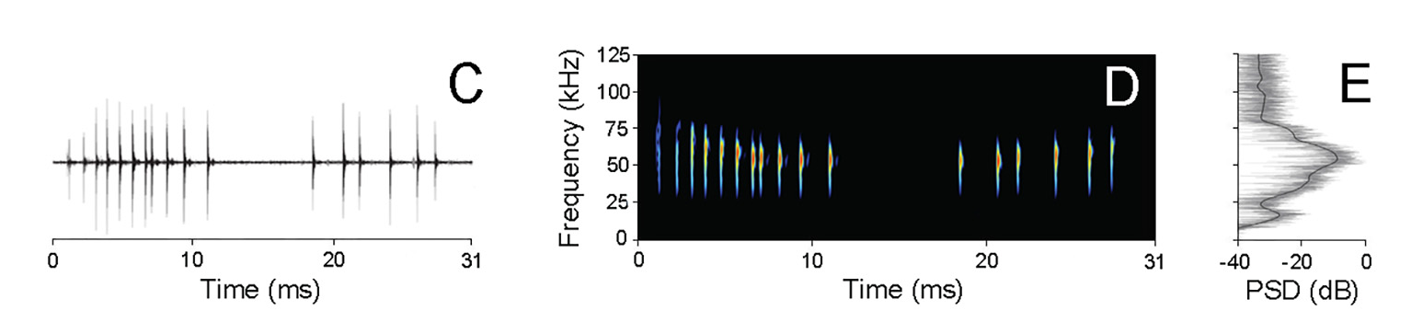
Warning clicks occupy a small fraction of time
Dowdy and Conner quantified complete tymbal modulation cycles rather than describing moth ultrasound only by its peak frequency. An oscillogram measures sound amplitude over time, while a spectrogram represents its frequency content through time.
P. roseicapitis clicks peaked near 54.0 kHz and reached 76.9 dB peSPL at 5 cm. C. martini clicks peaked near 60.9 kHz and reached 74.6 dB peSPL at that distance. Maximum duty cycles were only 6.1% and 5.7%, respectively.
Dowdy & Conner (2016), Fig. 1(C–E). Click waveform, spectrum, and spectral density DOI: 10.1371/journal.pone.0152981
These low duty cycles leave many potential bat echoes without an overlapping click. They are compatible with warning signals and relatively weak interference, rather than proving powerful jamming. The signal’s defensive role depends on capture outcomes, predator responses, and the timing of clicks relative to echoes.
Dowdy & Conner (2016)
34
Notes:
• Dowdy and Conner quantified complete tymbal modulation cycles rather than describing moth ultrasound only by its peak frequency. An oscillogram measures sound amplitude over time, while a spectrogram represents its frequency content through time.
– Peak frequency gives only one dimension of the sound. Temporal occupancy determines how often a click can coincide with a returning echo, and the calibrated level depends on the stated measurement distance. Neither value alone proves what the bat does with the signal.
• P. roseicapitis clicks peaked near 54.0 kHz and reached 76.9 dB peSPL at 5 cm. C. martini clicks peaked near 60.9 kHz and reached 74.6 dB peSPL at that distance. Maximum duty cycles were only 6.1% and 5.7%, respectively.
• These low duty cycles leave many potential bat echoes without an overlapping click. They are compatible with warning signals and relatively weak interference, rather than proving powerful jamming. The signal’s defensive role depends on capture outcomes, predator responses, and the timing of clicks relative to echoes.
References:
Dowdy NJ, Conner WE (2016). Acoustic aposematism and evasive action in select chemically defended arctiine (Lepidoptera: Erebidae) species: Nonchalant or not? PLOS ONE 11(4): e0152981. https://doi.org/10.1371/journal.pone.0152981
Figure: Dowdy & Conner (2016), Fig. 1(C–E). Click waveform, spectrum, and spectral density DOI: 10.1371/journal.pone.0152981
Figure source: https://doi.org/10.1371/journal.pone.0152981

Slide 35
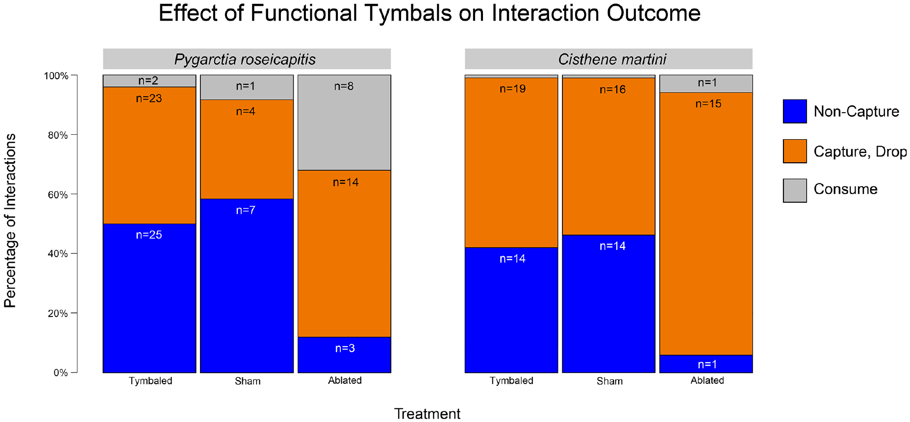
Tymbal ablation tests whether sound protects the moth
Dowdy and Conner compared intact tymbals, sham surgery, and tymbal ablation during attacks by wild bats. Ablation removes or disables the relevant structure; a sham procedure controls for handling and surgery without removing its function.
For P. roseicapitis, bats failed to capture 50% of intact moths but only 12% of ablated moths. Intact and sham-operated moths had lower capture risk than silenced individuals in both tested species, supporting a protective role for sound production.
Capture, release after capture, and consumption were scored separately. That distinction prevents equating survival after rejection with avoidance of contact. Ablation strengthens causal inference about sound, while the sham comparison helps reject surgery itself as the explanation for the outcome difference.
Dowdy & Conner (2016), Fig. 2. Intact, sham, and ablated capture outcomes DOI: 10.1371/journal.pone.0152981
Dowdy & Conner (2016)
35
Notes:
• Dowdy and Conner compared intact tymbals, sham surgery, and tymbal ablation during attacks by wild bats. Ablation removes or disables the relevant structure; a sham procedure controls for handling and surgery without removing its function.
– A moth can avoid capture or be captured and rejected; both may prevent consumption but entail different events. The experimental treatments separate the acoustic defense from the chemical defense encountered after contact.
• For P. roseicapitis, bats failed to capture 50% of intact moths but only 12% of ablated moths. Intact and sham-operated moths had lower capture risk than silenced individuals in both tested species, supporting a protective role for sound production.
• Capture, release after capture, and consumption were scored separately. That distinction prevents equating survival after rejection with avoidance of contact. Ablation strengthens causal inference about sound, while the sham comparison helps reject surgery itself as the explanation for the outcome difference.
References:
Dowdy NJ, Conner WE (2016). Acoustic aposematism and evasive action in select chemically defended arctiine (Lepidoptera: Erebidae) species: Nonchalant or not? PLOS ONE 11(4): e0152981. https://doi.org/10.1371/journal.pone.0152981
Figure: Dowdy & Conner (2016), Fig. 2. Intact, sham, and ablated capture outcomes DOI: 10.1371/journal.pone.0152981
Figure source: https://doi.org/10.1371/journal.pone.0152981

Slide 36
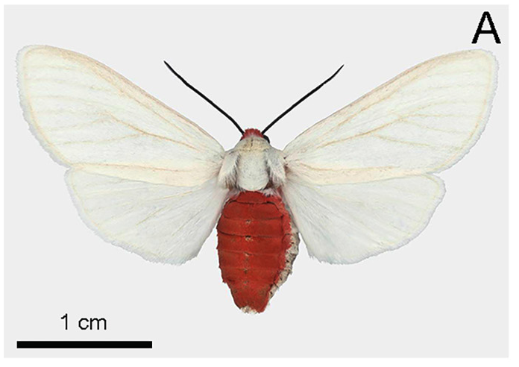
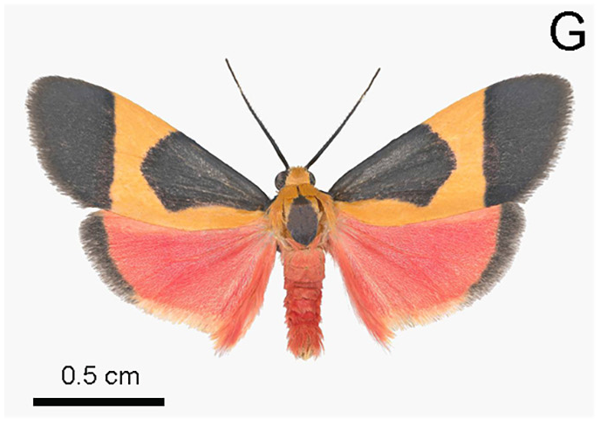
Chemical rejection is distinct from acoustic avoidance
Acoustic aposematism is a warning signal associated with an unprofitable or chemically defended prey. Dowdy and Conner used silenced moths to assess palatability without the immediate influence of warning clicks during approach.
Among captured, tymbal-ablated moths, bats rejected 64% of P. roseicapitis and 94% of C. martini. The comparison supports unpalatability even when sound was absent. Clicking and chemical rejection can therefore protect the moth at different stages of the encounter.
Sound-producing moths were also often avoided before contact. The combined pattern is consistent with acoustic warning, but these field observations do not isolate the chemical compounds responsible or experimentally reconstruct each bat’s previous learning history. Warning and weak interference need not be mutually exclusive.
Dowdy & Conner (2016), Fig. 1(A). Pygarctia roseicapitis specimen used in the chemical-defense comparison. DOI: 10.1371/journal.pone.0152981
Dowdy & Conner (2016), Fig. 1(G). Cisthene martini specimen used in the chemical-defense comparison. DOI: 10.1371/journal.pone.0152981
Dowdy & Conner (2016)
36
Notes:
• Acoustic aposematism is a warning signal associated with an unprofitable or chemically defended prey. Dowdy and Conner used silenced moths to assess palatability without the immediate influence of warning clicks during approach.
– A warning signal can alter approach before the predator tastes the prey. Chemical rejection operates after capture. Measuring both stages allows an acoustic defense to be distinguished from a purely post-contact defense without assuming that every predator has identical prior experience.
• Among captured, tymbal-ablated moths, bats rejected 64% of P. roseicapitis and 94% of C. martini. The comparison supports unpalatability even when sound was absent. Clicking and chemical rejection can therefore protect the moth at different stages of the encounter.
• Sound-producing moths were also often avoided before contact. The combined pattern is consistent with acoustic warning, but these field observations do not isolate the chemical compounds responsible or experimentally reconstruct each bat’s previous learning history. Warning and weak interference need not be mutually exclusive.
References:
Dowdy NJ, Conner WE (2016). Acoustic aposematism and evasive action in select chemically defended arctiine (Lepidoptera: Erebidae) species: Nonchalant or not? PLOS ONE 11(4): e0152981. https://doi.org/10.1371/journal.pone.0152981
Figure: Dowdy & Conner (2016), Fig. 1(A). Pygarctia roseicapitis specimen used in the chemical-defense comparison. DOI: 10.1371/journal.pone.0152981
Figure source: https://doi.org/10.1371/journal.pone.0152981
Figure: Dowdy & Conner (2016), Fig. 1(G). Cisthene martini specimen used in the chemical-defense comparison. DOI: 10.1371/journal.pone.0152981
Figure source: https://doi.org/10.1371/journal.pone.0152981

Slide 37
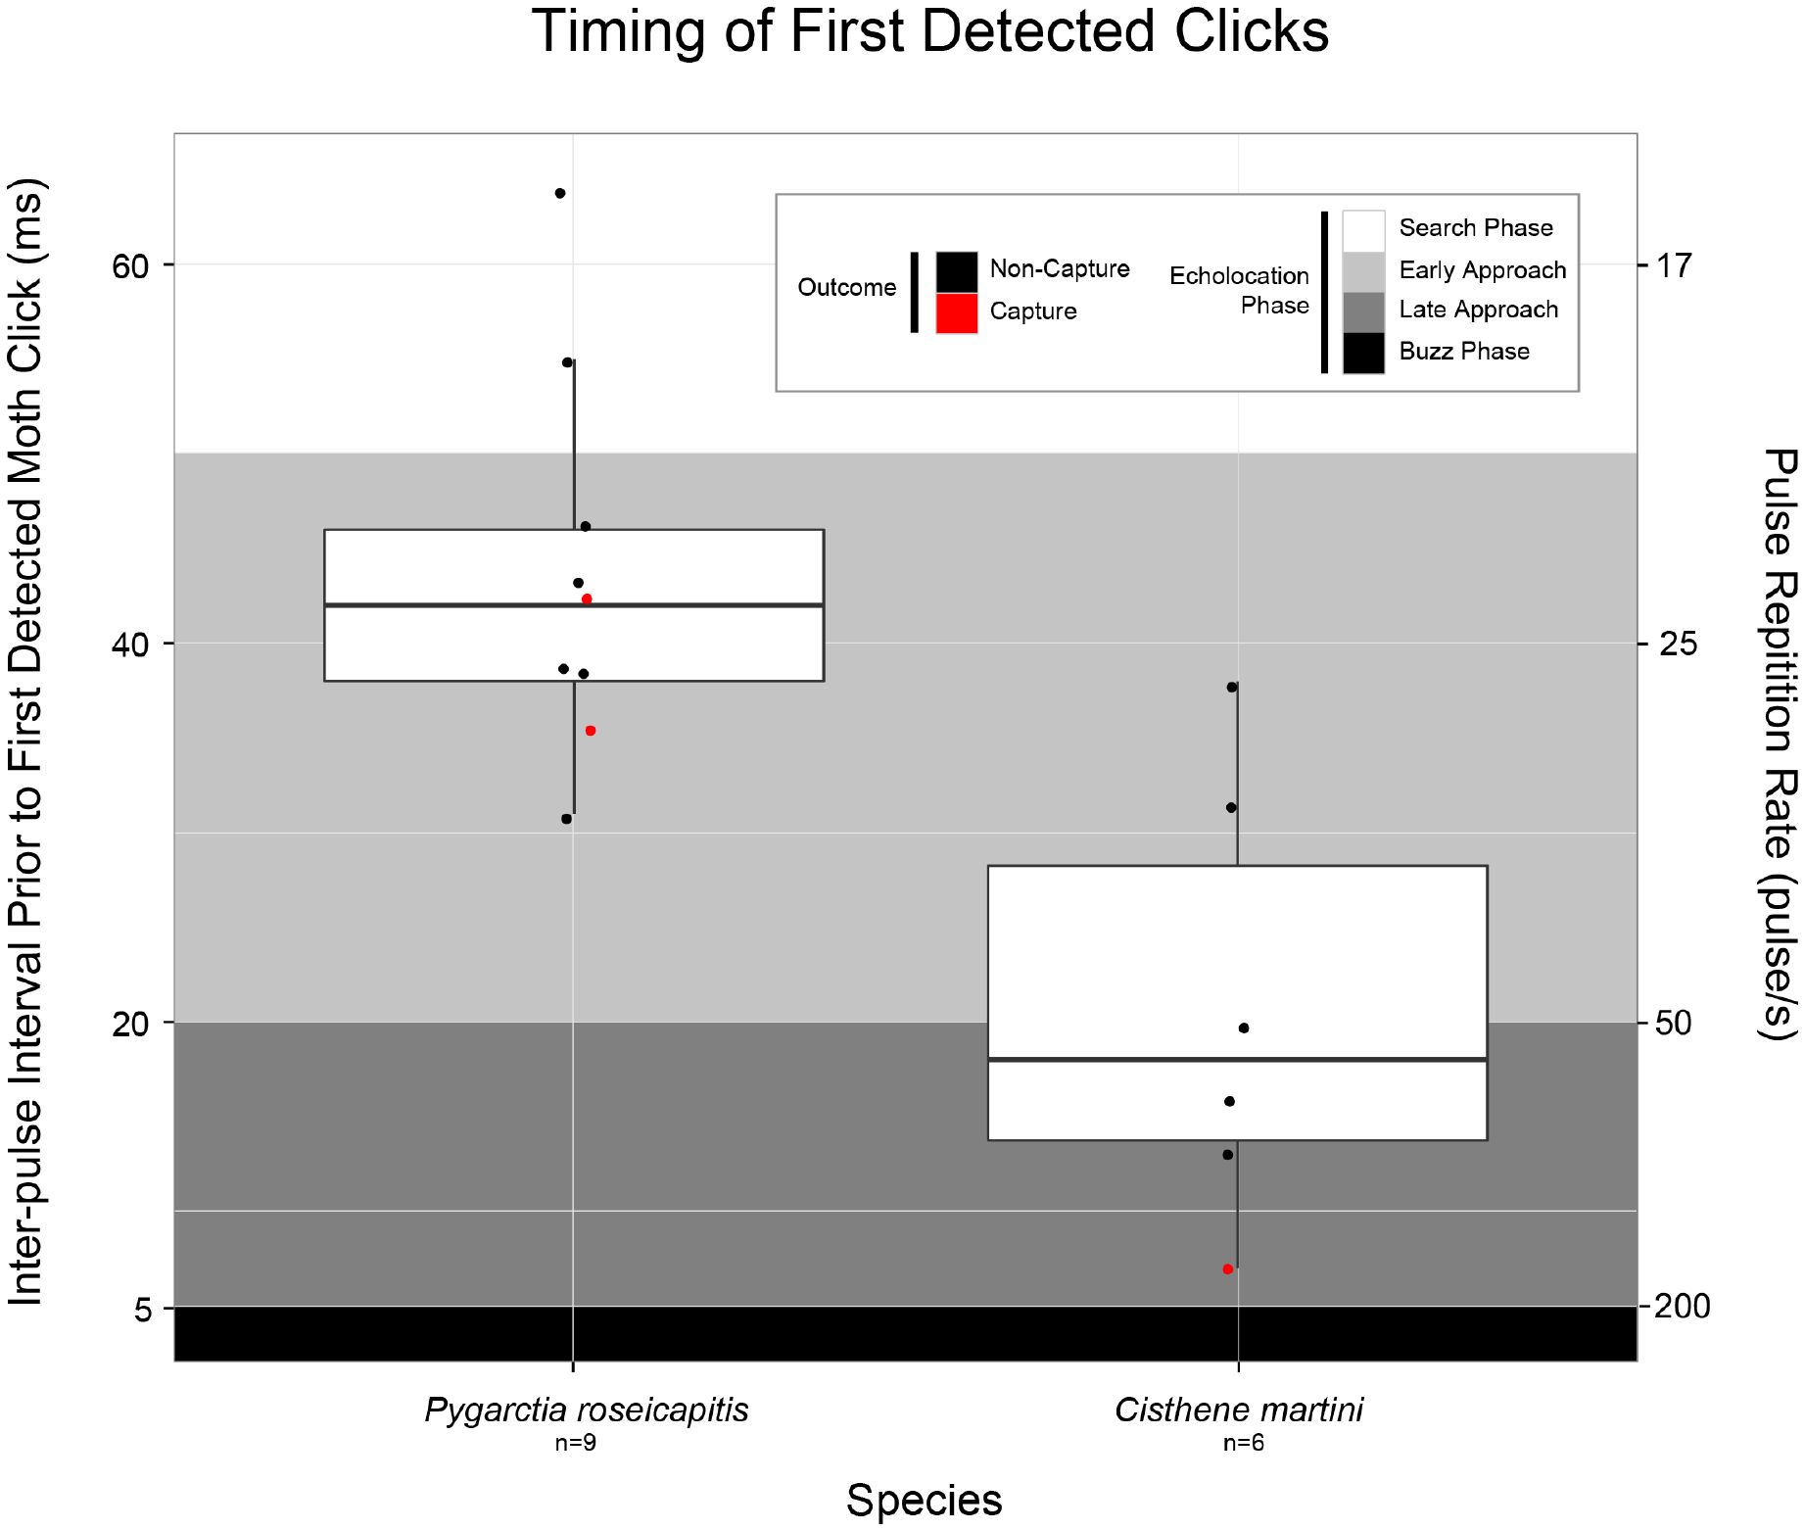
Species initiate warning clicks at different attack stages
Dowdy and Conner measured the interval between the two bat calls immediately preceding the first detectable moth clicks. That acoustic measure anchors moth response timing to the bat’s evolving attack rather than to an arbitrary trial clock.
P. roseicapitis first clicked at a mean interval of 44 ms, whereas C. martini first clicked at 21 ms. Their mean bat–moth distances at first detectable clicks were approximately 151 cm and 43 cm, respectively.
The first species therefore signaled earlier in the observed sequence. Detection limits matter because quieter or less frequent clicks can be missed until later. The measurements establish a difference in recorded warning onset, but do not isolate receptor threshold as its sole cause or prove that earlier clicking always guarantees escape.
Dowdy & Conner (2016), Fig. 3. Call interval preceding first detected clicks DOI: 10.1371/journal.pone.0152981
Dowdy & Conner (2016)
37
Notes:
• Dowdy and Conner measured the interval between the two bat calls immediately preceding the first detectable moth clicks. That acoustic measure anchors moth response timing to the bat’s evolving attack rather than to an arbitrary trial clock.
– The two species differ in their signal output as well as their behavior. A microphone detects a signal only when it exceeds the recording limits, so recorded onset can follow the moth’s earliest actual click. The paper explicitly treats this as a possible timing bias.
• P. roseicapitis first clicked at a mean interval of 44 ms, whereas C. martini first clicked at 21 ms. Their mean bat–moth distances at first detectable clicks were approximately 151 cm and 43 cm, respectively.
• The first species therefore signaled earlier in the observed sequence. Detection limits matter because quieter or less frequent clicks can be missed until later. The measurements establish a difference in recorded warning onset, but do not isolate receptor threshold as its sole cause or prove that earlier clicking always guarantees escape.
References:
Dowdy NJ, Conner WE (2016). Acoustic aposematism and evasive action in select chemically defended arctiine (Lepidoptera: Erebidae) species: Nonchalant or not? PLOS ONE 11(4): e0152981. https://doi.org/10.1371/journal.pone.0152981
Figure: Dowdy & Conner (2016), Fig. 3. Call interval preceding first detected clicks DOI: 10.1371/journal.pone.0152981
Figure source: https://doi.org/10.1371/journal.pone.0152981

Slide 38
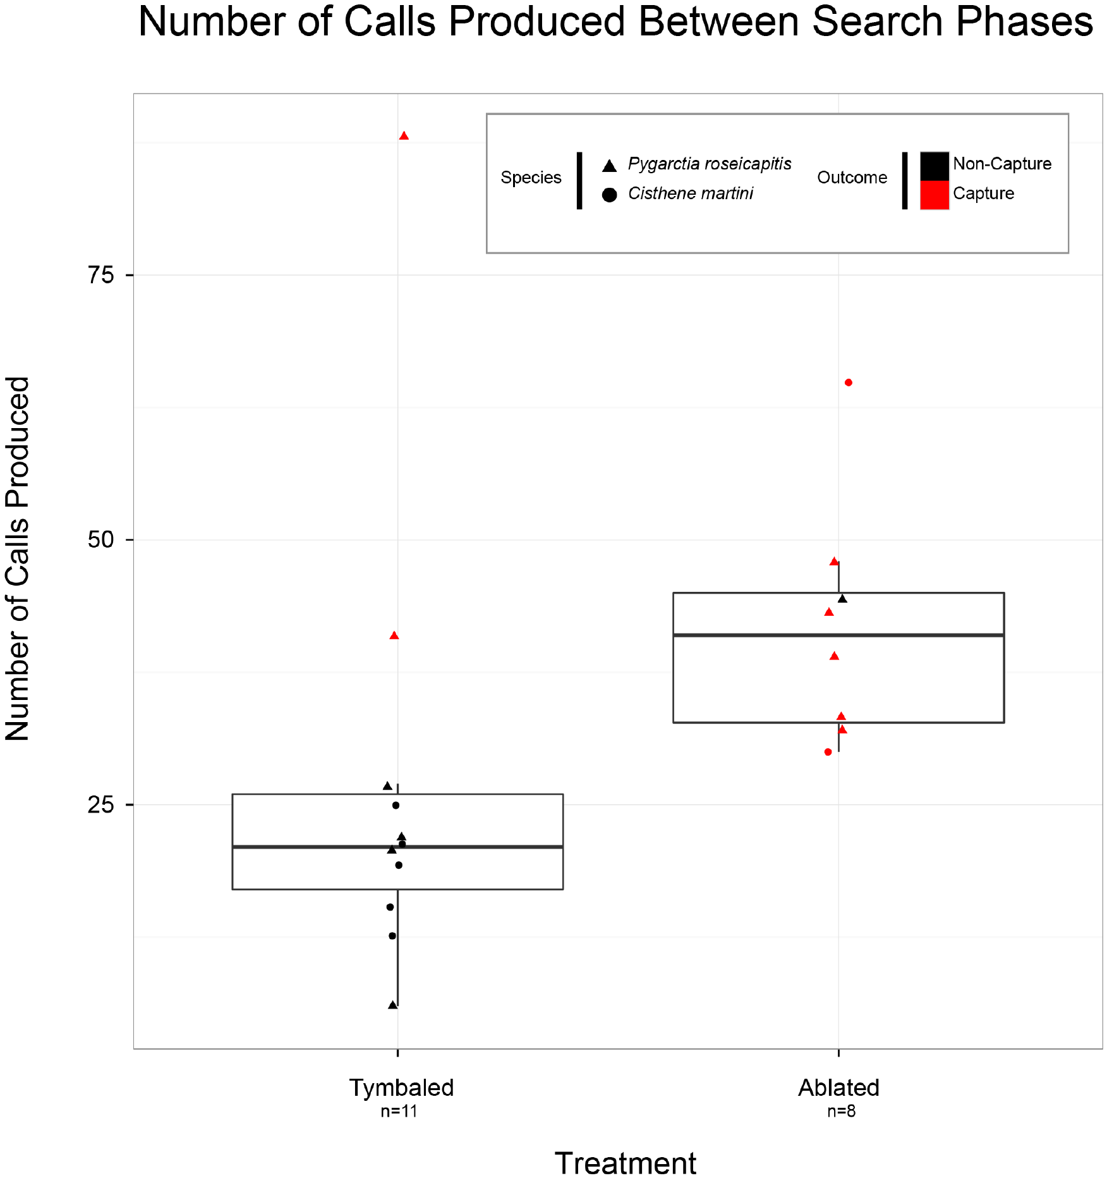
Bats can abort an attack after warning sounds
A bat returning to search after a warning signal should end an approach sequence without completing the usual terminal buzz. Dowdy and Conner counted calls between the start of approach and the return to search in acoustically recorded field interactions.
Attacks on silenced moths contained an average of 42 calls, compared with 27 during interactions with sound-producing moths. The reduced call sequence was associated with aborted pursuit rather than merely with the moth’s later rejection after contact.
This comparison links warning output to a change in predator behavior. It does not measure a fixed number of calls required for recognition, and some sound-producing moths were still captured. The defensive effect is a shift in encounter outcomes, not an absolute barrier to predation.
Dowdy & Conner (2016), Fig. 4. Calls between search phases by treatment DOI: 10.1371/journal.pone.0152981
Dowdy & Conner (2016)
38
Notes:
• A bat returning to search after a warning signal should end an approach sequence without completing the usual terminal buzz. Dowdy and Conner counted calls between the start of approach and the return to search in acoustically recorded field interactions.
– Call count is a behavioral proxy for how far the bat proceeds through the attack. The acoustic recordings and three-dimensional trajectories provide complementary evidence: stopping pursuit can alter both the call sequence and the closest approach to the moth.
• Attacks on silenced moths contained an average of 42 calls, compared with 27 during interactions with sound-producing moths. The reduced call sequence was associated with aborted pursuit rather than merely with the moth’s later rejection after contact.
• This comparison links warning output to a change in predator behavior. It does not measure a fixed number of calls required for recognition, and some sound-producing moths were still captured. The defensive effect is a shift in encounter outcomes, not an absolute barrier to predation.
References:
Dowdy NJ, Conner WE (2016). Acoustic aposematism and evasive action in select chemically defended arctiine (Lepidoptera: Erebidae) species: Nonchalant or not? PLOS ONE 11(4): e0152981. https://doi.org/10.1371/journal.pone.0152981
Figure: Dowdy & Conner (2016), Fig. 4. Calls between search phases by treatment DOI: 10.1371/journal.pone.0152981
Figure source: https://doi.org/10.1371/journal.pone.0152981

Slide 39
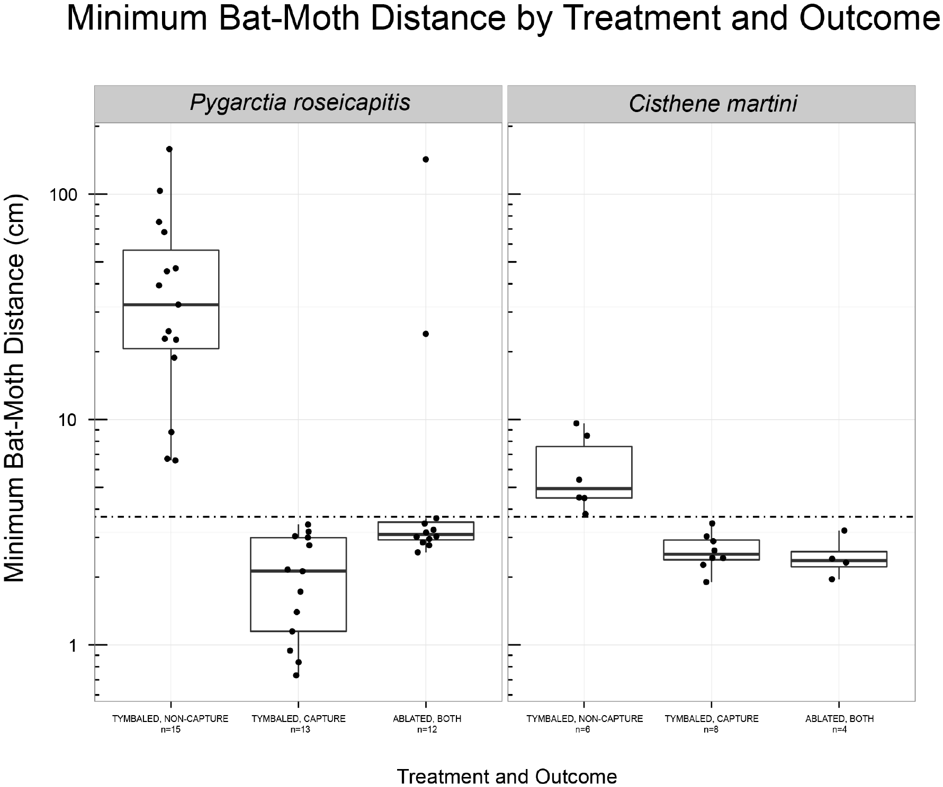
Closest approach distinguishes avoidance from rejection
The minimum bat–moth distance is the closest separation reconstructed during an encounter. It helps distinguish a predator that avoids contact from one that captures a moth and then drops it.
For non-captured, sound-producing P. roseicapitis, mean closest approach was approximately 33 cm; for C. martini, it was approximately 6 cm. Capture-and-drop events fell below the experiment’s conservative 3.7-cm spatial-resolution boundary.
Distances smaller than that boundary could not be treated as reliably separated positions. The species difference supports distinct encounter dynamics, but it cannot be attributed uniquely to click timing because evasive movement also differed. Spatial calibration and behavioral treatment are both necessary for interpreting an apparently near miss.
Dowdy & Conner (2016), Fig. 5. Closest approach with the resolution boundary DOI: 10.1371/journal.pone.0152981
Dowdy & Conner (2016)
39
Notes:
• The minimum bat–moth distance is the closest separation reconstructed during an encounter. It helps distinguish a predator that avoids contact from one that captures a moth and then drops it.
– A three-dimensional reconstruction has finite measurement accuracy. The dashed boundary in the original figure marks a practical limit on deciding whether bat and moth occupied different locations. It prevents interpreting millimeter-scale separation that the measurement cannot resolve.
• For non-captured, sound-producing P. roseicapitis, mean closest approach was approximately 33 cm; for C. martini, it was approximately 6 cm. Capture-and-drop events fell below the experiment’s conservative 3.7-cm spatial-resolution boundary.
• Distances smaller than that boundary could not be treated as reliably separated positions. The species difference supports distinct encounter dynamics, but it cannot be attributed uniquely to click timing because evasive movement also differed. Spatial calibration and behavioral treatment are both necessary for interpreting an apparently near miss.
References:
Dowdy NJ, Conner WE (2016). Acoustic aposematism and evasive action in select chemically defended arctiine (Lepidoptera: Erebidae) species: Nonchalant or not? PLOS ONE 11(4): e0152981. https://doi.org/10.1371/journal.pone.0152981
Figure: Dowdy & Conner (2016), Fig. 5. Closest approach with the resolution boundary DOI: 10.1371/journal.pone.0152981
Figure source: https://doi.org/10.1371/journal.pone.0152981

Slide 40
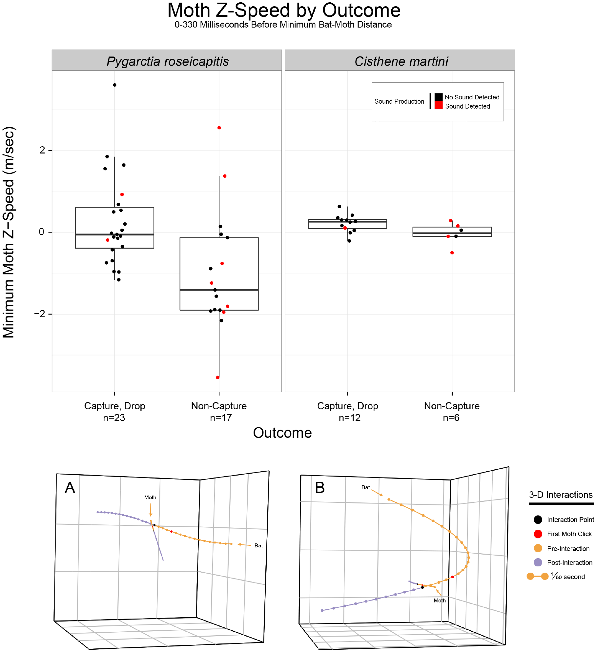
Vertical speed quantifies a moth’s evasive dive
A downward trajectory can be measured rather than classified only by visual impression. Dowdy and Conner reconstructed vertical, or z-axis, speed during the 333 ms before the closest bat–moth approach; negative speed indicates descent.
Non-captured P. roseicapitis descended at a mean vertical speed of approximately −1.01 m/s. Non-captured C. martini remained near level flight, averaging approximately −0.03 m/s. The original trajectories also distinguish moth motion from the bat’s simultaneous path.
The association supports a combination of warning and diving in P. roseicapitis, while C. martini often escaped without a comparable dive. A measured descent is not proof that diving alone caused escape, because acoustic signaling and predator behavior occurred during the same encounters.
Dowdy & Conner (2016), Fig. 6(A,B and z-speed plot). Measured vertical speed and flight trajectories DOI: 10.1371/journal.pone.0152981
Dowdy & Conner (2016)
40
Notes:
• A downward trajectory can be measured rather than classified only by visual impression. Dowdy and Conner reconstructed vertical, or z-axis, speed during the 333 ms before the closest bat–moth approach; negative speed indicates descent.
– Vertical speed supplies a quantitative definition of diving that can be related to encounter outcome. The published trajectory panels represent actual reconstructed flight data. They preserve the timing of the first detected click and the point of closest approach.
• Non-captured P. roseicapitis descended at a mean vertical speed of approximately −1.01 m/s. Non-captured C. martini remained near level flight, averaging approximately −0.03 m/s. The original trajectories also distinguish moth motion from the bat’s simultaneous path.
• The association supports a combination of warning and diving in P. roseicapitis, while C. martini often escaped without a comparable dive. A measured descent is not proof that diving alone caused escape, because acoustic signaling and predator behavior occurred during the same encounters.
References:
Dowdy NJ, Conner WE (2016). Acoustic aposematism and evasive action in select chemically defended arctiine (Lepidoptera: Erebidae) species: Nonchalant or not? PLOS ONE 11(4): e0152981. https://doi.org/10.1371/journal.pone.0152981
Figure: Dowdy & Conner (2016), Fig. 6(A,B and z-speed plot). Measured vertical speed and flight trajectories DOI: 10.1371/journal.pone.0152981
Figure source: https://doi.org/10.1371/journal.pone.0152981

Slide 41
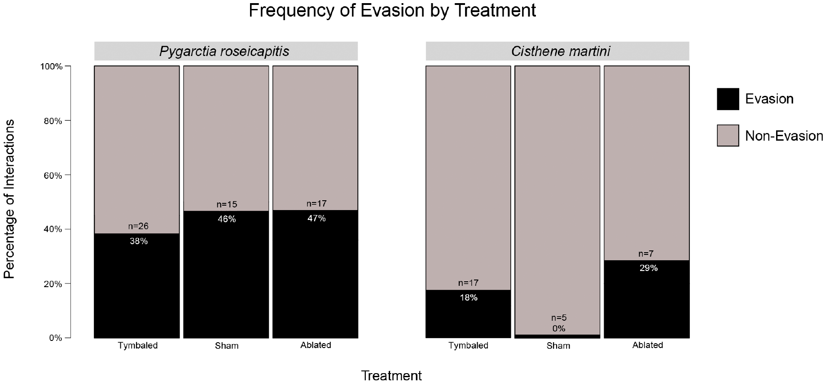
Warning and flight evasion are combined differently
A chemically defended moth need not rely exclusively on its warning signal. Dowdy and Conner also classified visible dives across treatment groups, testing whether sound production and evasive movement formed a single obligatory response.
P. roseicapitis used evasive dives in 43% of classified encounters, compared with 17% for C. martini. Tymbal treatment did not clearly change the frequency of diving within either species, even though it altered capture outcomes.
Acoustic defense and escape movement therefore have separable contributions. The species with more frequent diving is not simply a silent moth, and the less evasive species is not defenseless. The comparative data establish different combinations of defenses without identifying the evolutionary cause of the difference.
Dowdy & Conner (2016), Fig. 7. Dive frequency across tymbal treatments DOI: 10.1371/journal.pone.0152981
Dowdy & Conner (2016)
41
Notes:
• A chemically defended moth need not rely exclusively on its warning signal. Dowdy and Conner also classified visible dives across treatment groups, testing whether sound production and evasive movement formed a single obligatory response.
– The ablation experiment changes acoustic output while leaving the possibility of a dive. Similar dive frequencies across treatments, together with different capture outcomes, support a contribution of sound that cannot be reduced to a surgery-induced change in diving.
• P. roseicapitis used evasive dives in 43% of classified encounters, compared with 17% for C. martini. Tymbal treatment did not clearly change the frequency of diving within either species, even though it altered capture outcomes.
• Acoustic defense and escape movement therefore have separable contributions. The species with more frequent diving is not simply a silent moth, and the less evasive species is not defenseless. The comparative data establish different combinations of defenses without identifying the evolutionary cause of the difference.
References:
Dowdy NJ, Conner WE (2016). Acoustic aposematism and evasive action in select chemically defended arctiine (Lepidoptera: Erebidae) species: Nonchalant or not? PLOS ONE 11(4): e0152981. https://doi.org/10.1371/journal.pone.0152981
Figure: Dowdy & Conner (2016), Fig. 7. Dive frequency across tymbal treatments DOI: 10.1371/journal.pone.0152981
Figure source: https://doi.org/10.1371/journal.pone.0152981

Slide 42
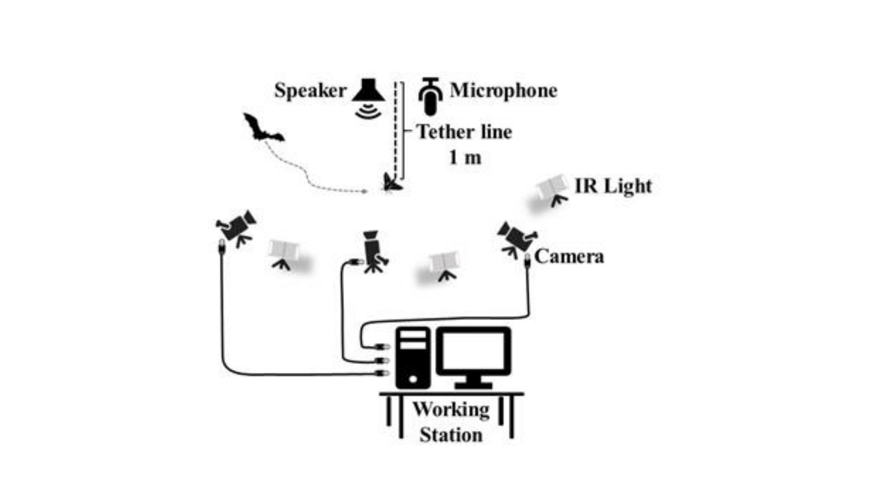
High acoustic duty cycle increases sonar interference
Sonar jamming disrupts a bat’s use of returning echoes rather than simply warning that prey is unpalatable. Fernández and colleagues played B. trigona-like click signals during attacks on tethered moths and varied their duty cycle across fourteen conditions.
Bats captured 77% of targets in the silent control. Capture success declined as moth-signal duty cycle increased. More time occupied by clicks increases the opportunity for acoustic interference near returning echoes, although the experiment did not directly record the bat’s neural representation of distance.
The results did not support a sharp duty-cycle threshold separating warning from jamming. Instead, interference varied across a continuum. The tested playback reproduced a controlled moth-signal pattern from a speaker, so generalization to moving, freely clicking prey and other bat species requires additional evidence.
Fernández et al. (2022), Supplementary Fig. S2. Published outdoor-arena preparation for controlled moth-sound playback. DOI: 10.1242/jeb.244187
Fernández et al. (2022)
42
Notes:
• Sonar jamming disrupts a bat’s use of returning echoes rather than simply warning that prey is unpalatable. Fernández and colleagues played B. trigona-like click signals during attacks on tethered moths and varied their duty cycle across fourteen conditions.
– The artificial signals in this experiment were acoustic stimuli used by the researchers; no reconstructed scientific image is needed to report their result. Duty cycle changes the probability of click–echo overlap, while the actual bat capture outcome is the functional measure of interference.
• Bats captured 77% of targets in the silent control. Capture success declined as moth-signal duty cycle increased. More time occupied by clicks increases the opportunity for acoustic interference near returning echoes, although the experiment did not directly record the bat’s neural representation of distance.
• The results did not support a sharp duty-cycle threshold separating warning from jamming. Instead, interference varied across a continuum. The tested playback reproduced a controlled moth-signal pattern from a speaker, so generalization to moving, freely clicking prey and other bat species requires additional evidence.
References:
Fernández Y, Dowdy NJ, Conner WE (2022). High duty cycle moth sounds jam bat echolocation: bats counter with compensatory changes in buzz duration. Journal of Experimental Biology 225(18): jeb244187. https://doi.org/10.1242/jeb.244187
Figure: Fernández et al. (2022), Supplementary Fig. S2. Published outdoor-arena preparation for controlled moth-sound playback. DOI: 10.1242/jeb.244187
Figure source: https://doi.org/10.1242/jeb.244187

Slide 43
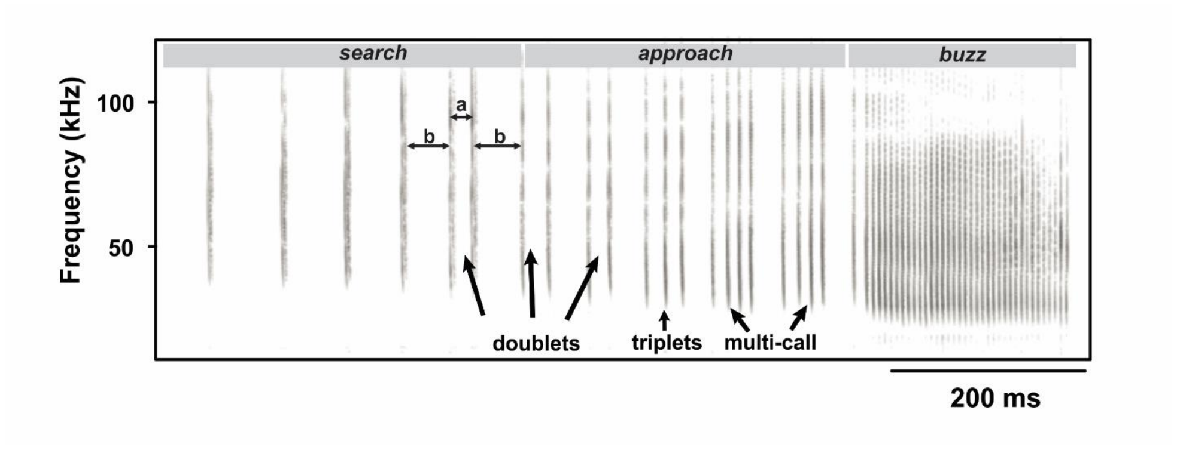
Bats compensate by extending their terminal buzz
The terminal buzz duration is the length of the rapid final call phase, distinct from the duration of one call. Fernández and colleagues measured it during the same controlled moth-click playback experiments that altered capture success.
Short buzzes of roughly 50–110 ms accompanied the lowest capture success. Longer buzzes were associated with better performance, and unsuccessful attacks increasingly contained longer buzzes as click duty cycle rose. The bat’s acoustic behavior therefore changed along with the interference condition.
The association supports compensatory sampling, but does not prove that buzz extension completely reverses jamming. Speaker position, tethered targets, and the limited tested bat population constrain the conclusion. The measured adjustment also does not establish an identical response to a chemically defended warning moth.
Fernández et al. (2022), Supplementary Fig. S1, entire spectrogram. A recorded bat attack progresses from search through approach to terminal buzz. DOI: 10.1242/jeb.244187
Fernández et al. (2022)
43
Notes:
• The terminal buzz duration is the length of the rapid final call phase, distinct from the duration of one call. Fernández and colleagues measured it during the same controlled moth-click playback experiments that altered capture success.
– A longer buzz can supply additional echoes, but the experiment measures the duration of the whole phase rather than independently manipulating every call parameter. Compensation is therefore supported as a behavioral interpretation, not as a fully isolated causal mechanism.
• Short buzzes of roughly 50–110 ms accompanied the lowest capture success. Longer buzzes were associated with better performance, and unsuccessful attacks increasingly contained longer buzzes as click duty cycle rose. The bat’s acoustic behavior therefore changed along with the interference condition.
• The association supports compensatory sampling, but does not prove that buzz extension completely reverses jamming. Speaker position, tethered targets, and the limited tested bat population constrain the conclusion. The measured adjustment also does not establish an identical response to a chemically defended warning moth.
References:
Fernández Y, Dowdy NJ, Conner WE (2022). High duty cycle moth sounds jam bat echolocation: bats counter with compensatory changes in buzz duration. Journal of Experimental Biology 225(18): jeb244187. https://doi.org/10.1242/jeb.244187
Figure: Fernández et al. (2022), Supplementary Fig. S1, entire spectrogram. A recorded bat attack progresses from search through approach to terminal buzz. DOI: 10.1242/jeb.244187
Figure source: https://doi.org/10.1242/jeb.244187

Slide 44
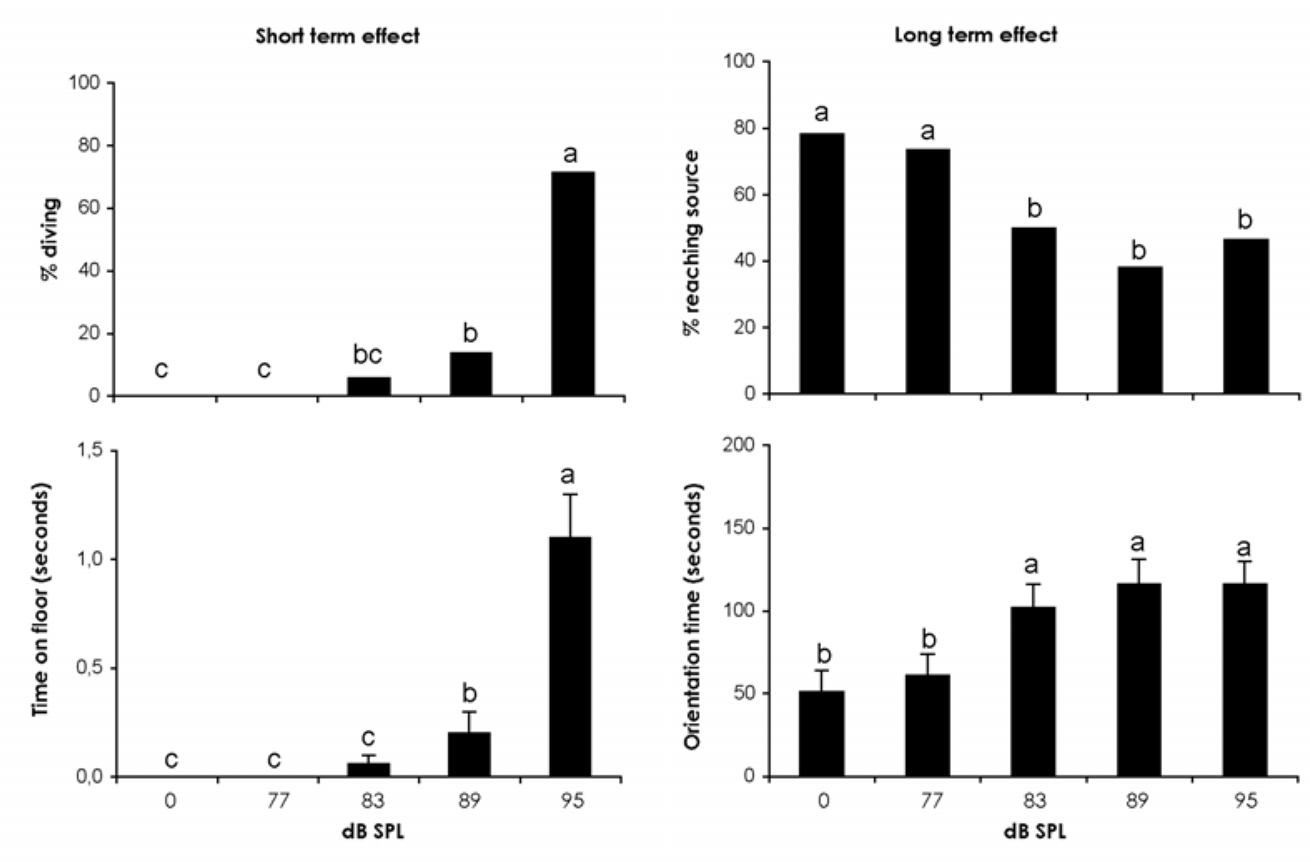
Predator cues interrupt pheromone-guided mate search
A moth may have to choose between reaching a mate and avoiding a predator. Svensson and colleagues presented male Plodia interpunctella with 50-kHz ultrasound while the males flew upwind through a sex-pheromone plume in a flight tunnel.
No clear evasive response occurred at 77 dB SPL, whereas 95 dB SPL caused most males to dive. In separate tethered tests, flight-stop sensitivity was greatest around 40–70 kHz, with a threshold near 70 dB SPL and a response latency near 71 ms.
Ultrasound at 83 dB SPL and above reduced successful arrival at the pheromone source and increased orientation time. Some males without a large visible dive also failed to continue searching. The behavioral trade-off does not establish direct inhibition of olfactory receptor neurons or identify the central neuromodulator involved.
Svensson et al. (2007), Fig. 2, all four plots. Ultrasound interrupts mate-directed flight immediately and during later orientation. DOI: 10.1673/031.007.5901
Svensson et al. (2007)
44
Notes:
• A moth may have to choose between reaching a mate and avoiding a predator. Svensson and colleagues presented male Plodia interpunctella with 50-kHz ultrasound while the males flew upwind through a sex-pheromone plume in a flight tunnel.
– The pheromone plume supplies a competing natural goal. Comparing upwind progress with sound-evoked movement distinguishes an immediate escape maneuver from the longer interruption of mate search. The experiment leaves the neural locus of that cross-modal interaction unresolved.
• No clear evasive response occurred at 77 dB SPL, whereas 95 dB SPL caused most males to dive. In separate tethered tests, flight-stop sensitivity was greatest around 40–70 kHz, with a threshold near 70 dB SPL and a response latency near 71 ms.
• Ultrasound at 83 dB SPL and above reduced successful arrival at the pheromone source and increased orientation time. Some males without a large visible dive also failed to continue searching. The behavioral trade-off does not establish direct inhibition of olfactory receptor neurons or identify the central neuromodulator involved.
References:
Svensson GP, Löfstedt C, Skals N (2007). Listening in pheromone plumes: disruption of olfactory-guided mate attraction in a moth by a bat-like ultrasound. Journal of Insect Science 7: 59, 1–9. https://doi.org/10.1673/031.007.5901
Figure: Svensson et al. (2007), Fig. 2, all four plots. Ultrasound interrupts mate-directed flight immediately and during later orientation. DOI: 10.1673/031.007.5901
Figure source: https://doi.org/10.1673/031.007.5901

Slide 45
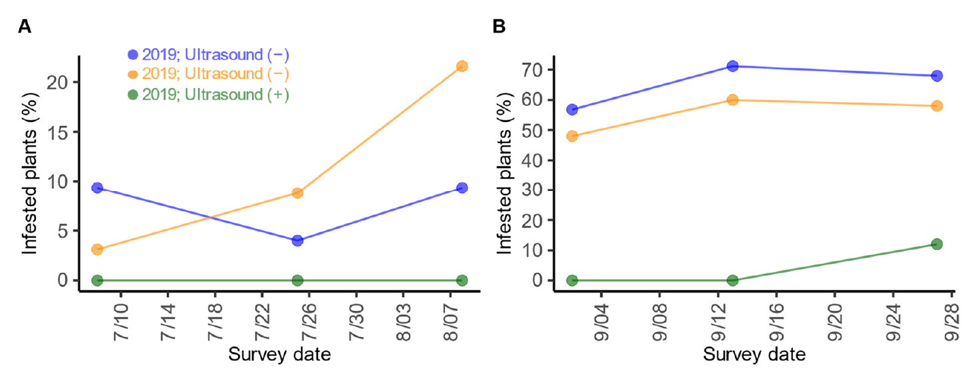
Ultrasound can suppress oviposition through avoidance
Nakano and colleagues applied the 6-ms, 10-Hz pulse sequence to gravid Spodoptera females approaching host plants. Oviposition is egg laying; preventing the adult’s approach can reduce later larval infestation without directly killing the larvae.
Field trials compared greenhouse or crop plots with and without night-time ultrasound. In strawberry greenhouses, egg-mass reduction persisted after normalization to regional moth abundance. In long green onion plots, ultrasonic treatment accompanied lower infestation despite fewer insecticide applications.
Nakano et al. (2022), Supplementary Fig. S6(A,B). Crop infestation under ultrasound and controls DOI: 10.1073/pnas.2211007119
The long-onion treatment received one application in each season, while controls received four in summer and nine in autumn. Those unequal management histories and field-level comparisons limit causal precision. The results support an applied consequence of avoidance, rather than proving a permanent absence of habituation or a universal control method.
Nakano et al. (2022)
45
Notes:
• Nakano and colleagues applied the 6-ms, 10-Hz pulse sequence to gravid Spodoptera females approaching host plants. Oviposition is egg laying; preventing the adult’s approach can reduce later larval infestation without directly killing the larvae.
– The applied endpoint is reduced access to host plants and fewer offspring, not a direct measure of receptor sensitivity. Population normalization addresses one background difference, while unequal chemical treatments and field histories remain reasons to avoid an unrestricted efficacy claim.
• Field trials compared greenhouse or crop plots with and without night-time ultrasound. In strawberry greenhouses, egg-mass reduction persisted after normalization to regional moth abundance. In long green onion plots, ultrasonic treatment accompanied lower infestation despite fewer insecticide applications.
• The long-onion treatment received one application in each season, while controls received four in summer and nine in autumn. Those unequal management histories and field-level comparisons limit causal precision. The results support an applied consequence of avoidance, rather than proving a permanent absence of habituation or a universal control method.
References:
Nakano R, Ito A, Tokumaru S (2022). Sustainable pest control inspired by prey–predator ultrasound interactions. Proceedings of the National Academy of Sciences 119(43): e2211007119. https://doi.org/10.1073/pnas.2211007119
Figure: Nakano et al. (2022), Supplementary Fig. S6(A,B). Crop infestation under ultrasound and controls DOI: 10.1073/pnas.2211007119
Figure source: https://doi.org/10.1073/pnas.2211007119

Slide 46
Key takeaways
Detection is not escape. Peripheral tuning and spike thresholds define available input; behavioral thresholds and escape repertoires depend on species, stimulus structure, and state.
A1 and A2 have different sensitivities. A1 supplies sensitive acoustic input; A2 adds information at stronger levels. A1 can initiate defensive clicking in Cycnia tenera without A2 activity.
Time changes the receptor code. Brief pulses integrate excitation, moderate tones can saturate firing, and long stimulation can adapt. Rate is not an unambiguous meter of predator distance.
Central processing transforms the input. Pulse and train markers, bilateral interactions, and downstream habituation separate the receptor burst from a defensive motor command.
Warning, jamming, and diving are distinct. Tymbal ablation tests acoustic protection; rejection tests unpalatability; click duty cycle alters interference; measured trajectories test evasive movement.
Risk is contextual. Received level and pulse timing jointly indicate targeting, while mate search and egg laying compete with avoidance. Each experiment constrains a specific causal claim.
Roeder (1966); Adams (1971); Ratcliffe et al. (2011); Dowdy & Conner (2016)
46
Notes:
• Detection is not escape. Peripheral tuning and spike thresholds define available input; behavioral thresholds and escape repertoires depend on species, stimulus structure, and state.
• A1 and A2 have different sensitivities. A1 supplies sensitive acoustic input; A2 adds information at stronger levels. A1 can initiate defensive clicking in Cycnia tenera without A2 activity.
• Time changes the receptor code. Brief pulses integrate excitation, moderate tones can saturate firing, and long stimulation can adapt. Rate is not an unambiguous meter of predator distance.
• Central processing transforms the input. Pulse and train markers, bilateral interactions, and downstream habituation separate the receptor burst from a defensive motor command.
• Warning, jamming, and diving are distinct. Tymbal ablation tests acoustic protection; rejection tests unpalatability; click duty cycle alters interference; measured trajectories test evasive movement.
• Risk is contextual. Received level and pulse timing jointly indicate targeting, while mate search and egg laying compete with avoidance. Each experiment constrains a specific causal claim.
References:
Roeder KD (1966). Auditory system of noctuid moths. Science 154(3756): 1515–1521. https://doi.org/10.1126/science.154.3756.1515
Adams WB (1971). Intensity characteristics of the noctuid acoustic receptor. Journal of General Physiology 58(5): 562–579. https://doi.org/10.1085/jgp.58.5.562
Ratcliffe JM, Fullard JH, Arthur BJ, Hoy RR (2011). Adaptive auditory risk assessment in the dogbane tiger moth when pursued by bats. Proceedings of the Royal Society B 278(1704): 364–370. https://doi.org/10.1098/rspb.2010.1488
Nakano R, Mason AC (2018). Early erratic flight response of the lucerne moth to the quiet echolocation calls of distant bats. PLOS ONE 13(8): e0202679. https://doi.org/10.1371/journal.pone.0202679
Nakano R, Ito A, Tokumaru S (2022). Sustainable pest control inspired by prey–predator ultrasound interactions. Proceedings of the National Academy of Sciences 119(43): e2211007119. https://doi.org/10.1073/pnas.2211007119
Corcoran AJ, Wagner RD, Conner WE (2013). Optimal predator risk assessment by the sonar-jamming arctiine moth Bertholdia trigona. PLOS ONE 8(5): e63609. https://doi.org/10.1371/journal.pone.0063609
Dowdy NJ, Conner WE (2016). Acoustic aposematism and evasive action in select chemically defended arctiine (Lepidoptera: Erebidae) species: Nonchalant or not? PLOS ONE 11(4): e0152981. https://doi.org/10.1371/journal.pone.0152981
Fernández Y, Dowdy NJ, Conner WE (2022). High duty cycle moth sounds jam bat echolocation: bats counter with compensatory changes in buzz duration. Journal of Experimental Biology 225(18): jeb244187. https://doi.org/10.1242/jeb.244187

