Slide 1
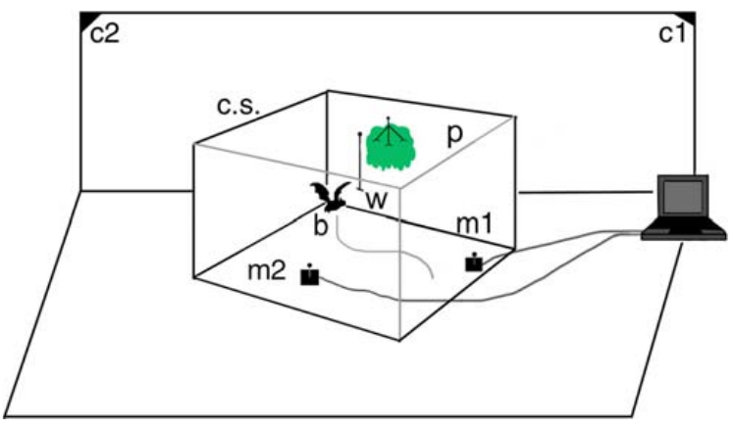
NEUR 411 · NEUROETHOLOGY · FALL 2026
Lecture 17
Bat echolocation II:
FM bats, target-range computation, clutter rejection
Friday, October 2, 2026
Jordan Lopez, Ph.D.
Professor of Neurobiology & Biomedical Engineering
Moss et al. (2006), Fig. 1. Big brown bat in the published flight-room experiment.
Notes:
Bat echolocation II: FM bats, target-range computation, clutter rejection
Lecture 17. NEUR 411 · NEUROETHOLOGY · FALL 2026. Friday, October 2, 2026.
Figure: Moss et al. (2006), Fig. 1. Big brown bat in the published flight-room experiment.
Figure source: https://doi.org/10.1371/journal.pbio.0040079

Slide 2
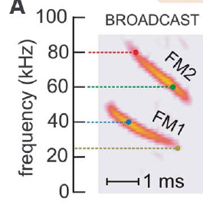
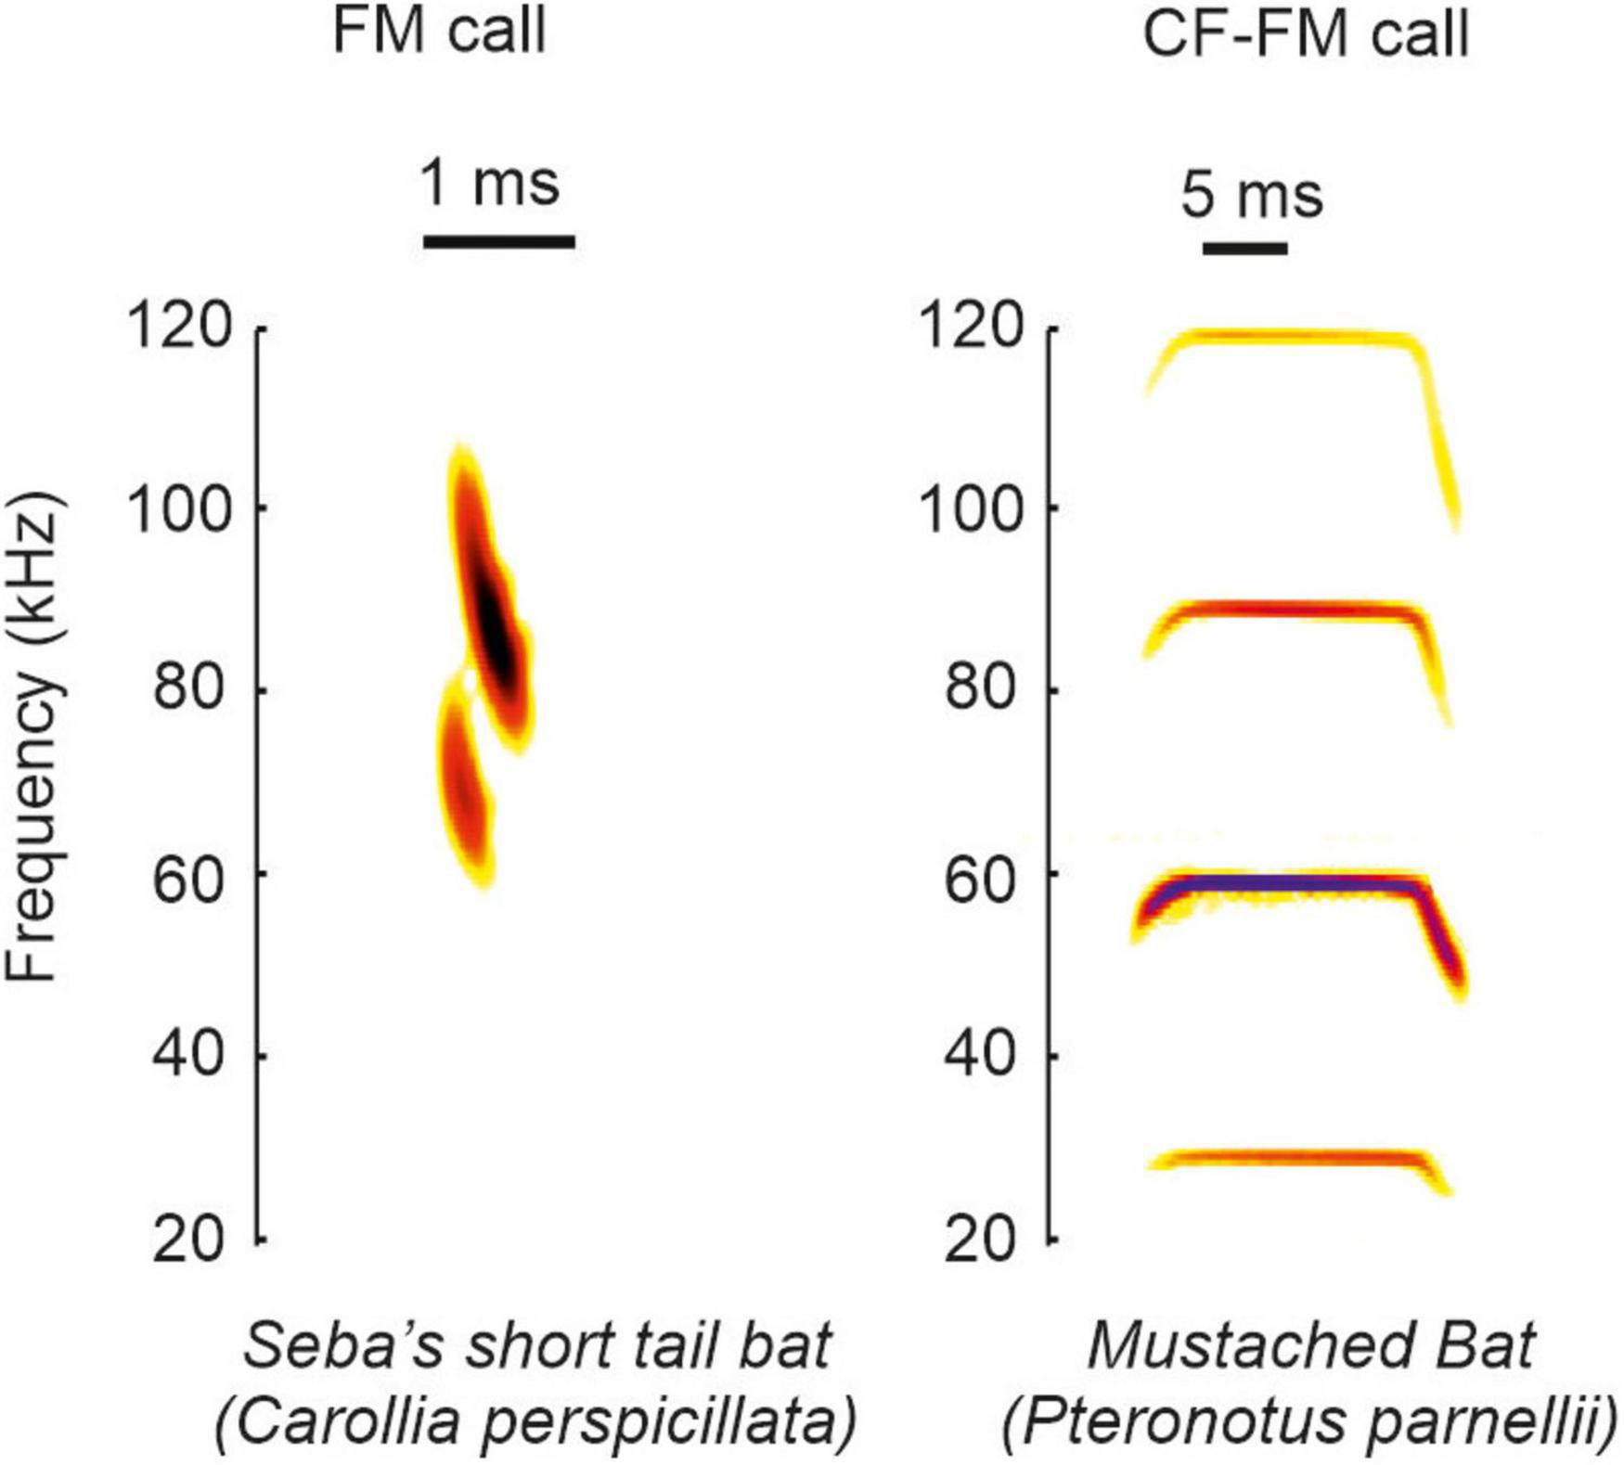
FM calls distribute acoustic energy across frequencies
Echolocation is active sensing with emitted sounds and returning echoes. A frequency-modulated sweep, or FM sweep, changes frequency during a call. Big brown bats, Eptesicus fuscus, emit downward sweeps with two prominent harmonics, components related by a twofold frequency ratio.
Ming and colleagues describe FM1 sweeping approximately from 55 to 25 kHz and FM2 from 110 to 50 kHz. These wide frequency ranges differ from a sustained constant-frequency carrier. An echo preserves information about when different frequencies were transmitted and returned.
Behavioral filtering experiments distinguish the contributions of these harmonics. FM1 can support echo-delay perception without FM2; FM2 cannot simply replace missing corresponding FM1 frequencies. The two acoustic components therefore contribute asymmetrically to the tested range judgments.
Bates et al. (2011), Fig. 1(A). Two downward FM harmonics in a big brown bat broadcast.
Beetz & Hechavarría (2022), Fig. 1. Spectrograms of an FM call (Carollia perspicillata) and a CF-FM call (Pteronotus parnellii).
Bates et al. (2011); Ming et al. (2020); Beetz & Hechavarría (2022)
02
Notes:
• Echolocation is active sensing with emitted sounds and returning echoes. A frequency-modulated sweep, or FM sweep, changes frequency during a call. Big brown bats, Eptesicus fuscus, emit downward sweeps with two prominent harmonics, components related by a twofold frequency ratio.
• Ming and colleagues describe FM1 sweeping approximately from 55 to 25 kHz and FM2 from 110 to 50 kHz. These wide frequency ranges differ from a sustained constant-frequency carrier. An echo preserves information about when different frequencies were transmitted and returned.
• Behavioral filtering experiments distinguish the contributions of these harmonics. FM1 can support echo-delay perception without FM2; FM2 cannot simply replace missing corresponding FM1 frequencies. The two acoustic components therefore contribute asymmetrically to the tested range judgments.
• A harmonic is defined by its frequency relationship to another component. FM1 and FM2 are not successive calls. They occur together within the broadcast, while each sweeps downward through its own frequency range.
References:
Bates ME, Simmons JA, Zorikov TV (2011). Bats use echo harmonic structure to distinguish their targets from background clutter. Science 333(6042):627–630. https://doi.org/10.1126/science.1202065
Ming C, Bates ME, Simmons JA (2020). How frequency hopping suppresses pulse-echo ambiguity in bat biosonar. Proceedings of the National Academy of Sciences 117(29):17288–17295. https://doi.org/10.1073/pnas.2001105117
Beetz MJ, Hechavarría JC (2022). Neural processing of naturalistic echolocation signals in bats. Frontiers in Neural Circuits 16:899370. https://doi.org/10.3389/fncir.2022.899370
Figure: Bates et al. (2011), Fig. 1(A). Two downward FM harmonics in a big brown bat broadcast.
Figure source: https://doi.org/10.1126/science.1202065
Figure: Beetz & Hechavarría (2022), Fig. 1. Spectrograms of an FM call (Carollia perspicillata) and a CF-FM call (Pteronotus parnellii).
Figure source: https://doi.org/10.3389/fncir.2022.899370

Slide 3
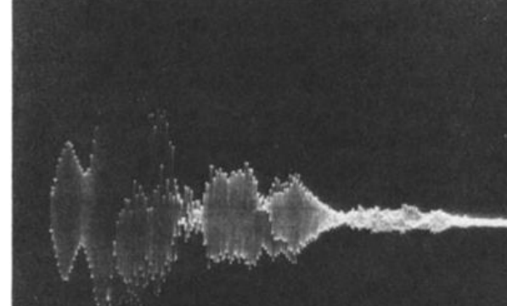
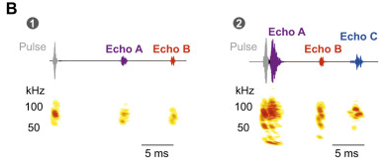
Echo delay specifies the round trip to a target
Echo delay is the interval between an outgoing call and its returning reflection. A more distant target produces a later echo because sound travels outward to the target and back to the bat. Target range is the distance from the bat to that reflector.
Simmons recorded outgoing sounds and echoes while bats discriminated target distance. A target at 30 cm returned an echo after about 1.7 ms in the experimental conditions. Electronic delay channels could change this interval while keeping the loudspeakers at fixed physical positions.
The resulting separation of acoustic delay from physical location permitted a direct behavioral test of the ranging cue. The bat could judge relative simulated distance from echo arrival time without receiving a corresponding change in the loudspeaker’s actual distance.
Simmons (1973), Fig. 11. Recorded outgoing sound and target echo at a range of 30 cm.
Beetz et al. (2026), Fig. 1B. Pulse followed by echoes from objects at different distances; oscillograms and spectrograms.
Simmons (1973); Beetz et al. (2026)
03
Notes:
• Echo delay is the interval between an outgoing call and its returning reflection. A more distant target produces a later echo because sound travels outward to the target and back to the bat. Target range is the distance from the bat to that reflector.
• Simmons recorded outgoing sounds and echoes while bats discriminated target distance. A target at 30 cm returned an echo after about 1.7 ms in the experimental conditions. Electronic delay channels could change this interval while keeping the loudspeakers at fixed physical positions.
• The resulting separation of acoustic delay from physical location permitted a direct behavioral test of the ranging cue. The bat could judge relative simulated distance from echo arrival time without receiving a corresponding change in the loudspeaker’s actual distance.
• The recorded echo followed the emitted call rather than arriving at the same time. Sound from apparatus supports also appeared in the recording, so the investigator distinguished target reflections from other returning sound.
References:
Simmons JA (1973). The resolution of target range by echolocating bats. Journal of the Acoustical Society of America 54(1):157–173. https://doi.org/10.1121/1.1913559
Beetz MJ, Kössl M, Hechavarría JC (2026). First come, first served: neuronal processing of multi-echo streams in the auditory cortex of echolocating bats. Journal of Experimental Biology 229(10):jeb252069. https://doi.org/10.1242/jeb.252069
Figure: Simmons (1973), Fig. 11. Recorded outgoing sound and target echo at a range of 30 cm.
Figure source: https://doi.org/10.1121/1.1913559
Figure: Beetz et al. (2026), Fig. 1B. Pulse followed by echoes from objects at different distances; oscillograms and spectrograms.
Figure source: https://doi.org/10.1242/jeb.252069

Slide 4
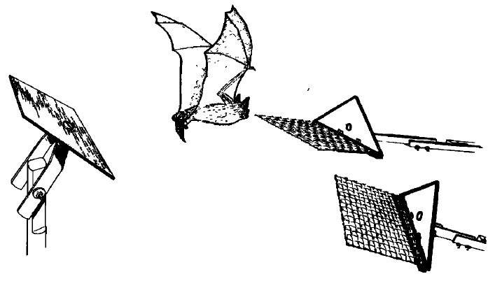
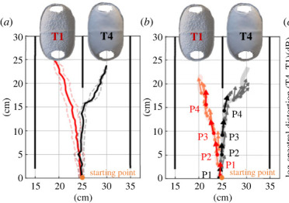
Bats can choose the nearer of two reflecting targets
Simmons trained bats to discriminate between two targets that differed in distance from a starting platform. The animal received food for moving to the landing platform associated with the nearer target. Discrimination here means choosing between simultaneously available alternatives.
One target remained at a fixed range, such as 30 or 60 cm, while the other was brought progressively closer to that range. Vision was excluded so that visual distance cues could not explain the choices. The triangular targets had the same form.
Performance deteriorated as the distance difference approached zero, reaching chance when both targets were equally distant. This procedure measured resolution of relative range differences. It did not measure the accuracy of an isolated absolute-distance estimate without a comparison target.
Simmons (1973), Fig. 1. Original two-target range-discrimination apparatus.
Teshima et al. (2024), Fig. 3a–b. Flight trajectories of bats approaching two targets in a two-choice test.
Simmons (1973); Teshima et al. (2024)
04
Notes:
• Simmons trained bats to discriminate between two targets that differed in distance from a starting platform. The animal received food for moving to the landing platform associated with the nearer target. Discrimination here means choosing between simultaneously available alternatives.
• One target remained at a fixed range, such as 30 or 60 cm, while the other was brought progressively closer to that range. Vision was excluded so that visual distance cues could not explain the choices. The triangular targets had the same form.
• Performance deteriorated as the distance difference approached zero, reaching chance when both targets were equally distant. This procedure measured resolution of relative range differences. It did not measure the accuracy of an isolated absolute-distance estimate without a comparison target.
• The food contingency linked the correct choice to the nearer reflector. Equal target shape removed a simple object-form cue, and excluding vision isolated the use of acoustic information during the distance choice.
References:
Simmons JA (1973). The resolution of target range by echolocating bats. Journal of the Acoustical Society of America 54(1):157–173. https://doi.org/10.1121/1.1913559
Teshima Y, Mogi M, Nishida H, Tsuchiya T, Kobayasi KI, Hiryu S (2024). Discrimination of object information by bat echolocation deciphered from acoustic simulations. Royal Society Open Science 11(1):231415. https://doi.org/10.1098/rsos.231415
Figure: Simmons (1973), Fig. 1. Original two-target range-discrimination apparatus.
Figure source: https://doi.org/10.1121/1.1913559
Figure: Teshima et al. (2024), Fig. 3a–b. Flight trajectories of bats approaching two targets in a two-choice test.
Figure source: https://doi.org/10.1098/rsos.231415

Slide 5
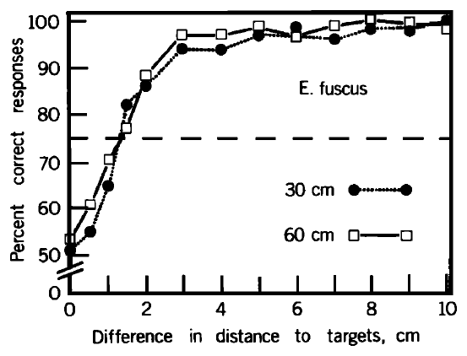
Near-range acuity remains similar at 30 and 60 cm
Range acuity is the smallest distance difference that supports a specified level of correct discrimination. Simmons used 75% correct choices as an operational criterion, between chance and nearly error-free performance in the two-target task.
Big brown bats discriminated range differences of approximately 12–14 mm at absolute ranges of 30 and 60 cm. Doubling target distance within this near-range comparison produced little change in the discrimination curve. Larger distance differences were much easier to distinguish.
The result supports approximately constant absolute resolution over these tested ranges. It does not establish that resolution remains independent of distance at every operating range. Echo audibility, propagation losses, and the conditions of the behavioral task constrain extrapolation to distant targets.
Simmons (1973), Fig. 2. Range-discrimination performance at absolute distances of 30 and 60 cm.
Simmons (1973)
05
Notes:
• Range acuity is the smallest distance difference that supports a specified level of correct discrimination. Simmons used 75% correct choices as an operational criterion, between chance and nearly error-free performance in the two-target task.
• Big brown bats discriminated range differences of approximately 12–14 mm at absolute ranges of 30 and 60 cm. Doubling target distance within this near-range comparison produced little change in the discrimination curve. Larger distance differences were much easier to distinguish.
• The result supports approximately constant absolute resolution over these tested ranges. It does not establish that resolution remains independent of distance at every operating range. Echo audibility, propagation losses, and the conditions of the behavioral task constrain extrapolation to distant targets.
• The threshold was a behavioral criterion chosen for comparing curves. A distance difference of zero leaves no nearer target, so choices must approach chance even if the bat hears both targets clearly.
References:
Simmons JA (1973). The resolution of target range by echolocating bats. Journal of the Acoustical Society of America 54(1):157–173. https://doi.org/10.1121/1.1913559
Figure: Simmons (1973), Fig. 2. Range-discrimination performance at absolute distances of 30 and 60 cm.
Figure source: https://doi.org/10.1121/1.1913559

Slide 6
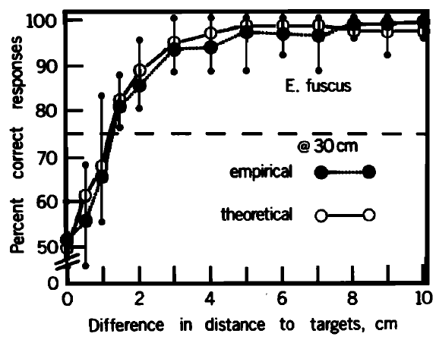
Behavioral resolution is narrower than target distance
At an absolute range of 30 cm, big brown bats performed almost without errors when targets differed by several centimeters. Their choices became progressively less reliable as the separation fell toward the millimeter-scale threshold. Absolute target distance and resolvable distance difference are distinct quantities.
Simmons compared this measured discrimination curve with a prediction derived from the recorded sonar signal. The prediction used the signal’s autocorrelation envelope, a measure of similarity between a waveform and delayed versions of itself, with rapid carrier fluctuations removed.
Agreement supported a receiver matched to features of the transmitted signal. It did not directly identify the neurons performing that computation, and a correspondence between a behavioral curve and a signal-based prediction does not prove a unique cellular implementation.
Simmons (1973), Fig. 3. Measured discrimination and the paper’s signal-based prediction at 30 cm.
Simmons (1973)
06
Notes:
• At an absolute range of 30 cm, big brown bats performed almost without errors when targets differed by several centimeters. Their choices became progressively less reliable as the separation fell toward the millimeter-scale threshold. Absolute target distance and resolvable distance difference are distinct quantities.
• Simmons compared this measured discrimination curve with a prediction derived from the recorded sonar signal. The prediction used the signal’s autocorrelation envelope, a measure of similarity between a waveform and delayed versions of itself, with rapid carrier fluctuations removed.
• Agreement supported a receiver matched to features of the transmitted signal. It did not directly identify the neurons performing that computation, and a correspondence between a behavioral curve and a signal-based prediction does not prove a unique cellular implementation.
• The empirical curve represents actual choices. The theoretical curve was published by the investigator as a prediction from the bat’s recorded signal. A matched receiver is a proposed interpretation of their relationship.
References:
Simmons JA (1973). The resolution of target range by echolocating bats. Journal of the Acoustical Society of America 54(1):157–173. https://doi.org/10.1121/1.1913559
Figure: Simmons (1973), Fig. 3. Measured discrimination and the paper’s signal-based prediction at 30 cm.
Figure source: https://doi.org/10.1121/1.1913559

Slide 7
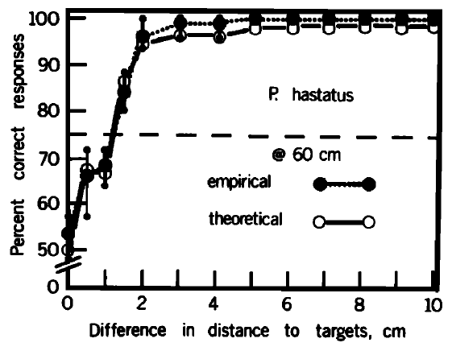
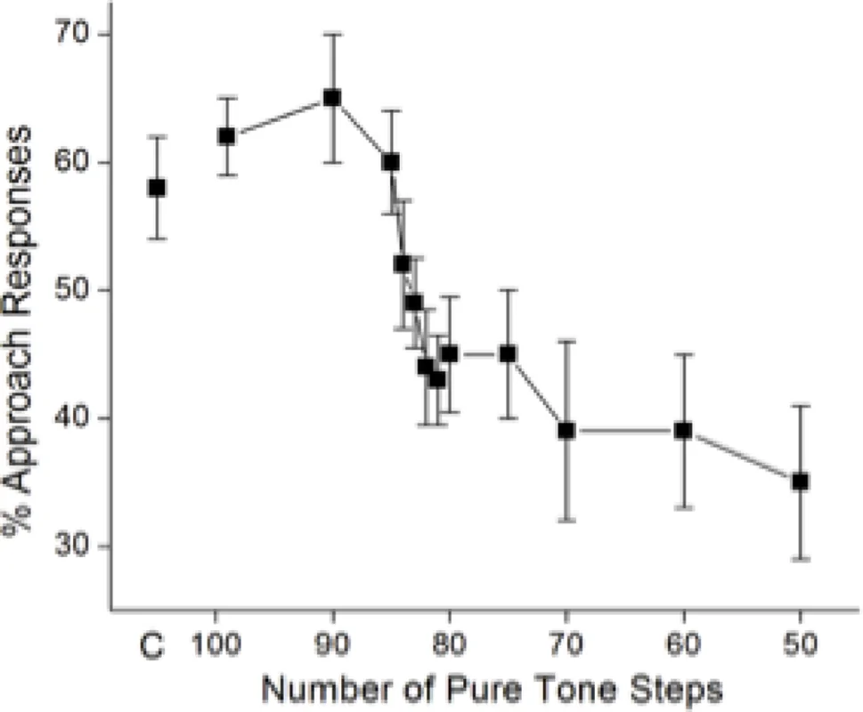
Range discrimination occurs across sonar signal types
Simmons compared range discrimination in bats using different sonar signals. Eptesicus fuscus and Phyllostomus hastatus used FM sounds, whereas the other tested species used combinations of constant-frequency and FM components. The species were tested with the same general nearer-target contingency.
The first three species resolved differences near 1–2 cm; Rhinolophus ferrumequinum had a threshold nearer 3 cm. In Phyllostomus, discrimination at 60 and 120 cm had similar resolution. Signal form did not divide the animals into ranging and non-ranging groups.
The paper inferred different contributions of signal components across species. These comparisons establish behavioral capabilities under the tested conditions, rather than an identical neural algorithm in all bats. Species-specific auditory processing must be distinguished from their shared ability to compare target ranges.
Simmons (1973), Fig. 5. Range discrimination by Phyllostomus hastatus at 60 cm.
Grinnell (2026), Fig. 9. Approach responses of big brown bats to artificial echoes built from pure-tone steps.
Simmons (1973); Grinnell (2026)
07
Notes:
• Simmons compared range discrimination in bats using different sonar signals. Eptesicus fuscus and Phyllostomus hastatus used FM sounds, whereas the other tested species used combinations of constant-frequency and FM components. The species were tested with the same general nearer-target contingency.
• The first three species resolved differences near 1–2 cm; Rhinolophus ferrumequinum had a threshold nearer 3 cm. In Phyllostomus, discrimination at 60 and 120 cm had similar resolution. Signal form did not divide the animals into ranging and non-ranging groups.
• The paper inferred different contributions of signal components across species. These comparisons establish behavioral capabilities under the tested conditions, rather than an identical neural algorithm in all bats. Species-specific auditory processing must be distinguished from their shared ability to compare target ranges.
• The Phyllostomus data provide a second FM species comparison. Similar relative-range performance is evidence of a shared sensory capability, but it does not imply that the two species have identical call structure or auditory circuits.
References:
Simmons JA (1973). The resolution of target range by echolocating bats. Journal of the Acoustical Society of America 54(1):157–173. https://doi.org/10.1121/1.1913559
Grinnell AD (2026). Reflections on the neural processing of echoes for distance information in echolocating bats. Journal of Comparative Physiology A 212(5):913–926. https://doi.org/10.1007/s00359-026-01804-6
Figure: Simmons (1973), Fig. 5. Range discrimination by Phyllostomus hastatus at 60 cm.
Figure source: https://doi.org/10.1121/1.1913559
Figure: Grinnell (2026), Fig. 9. Approach responses of big brown bats to artificial echoes built from pure-tone steps.
Figure source: https://doi.org/10.1007/s00359-026-01804-6

Slide 8
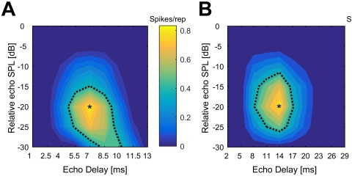
Electronic echoes isolate arrival time from other cues
An electronic target simulator captures a bat’s emitted sound, delays it, and returns it through a loudspeaker. Simmons used two independent microphone–delay–speaker channels to present echoes with different arrival times. The hardware could preserve other range-related acoustic properties while changing delay.
The loudspeakers remained fixed, and overall level and spectrum were controlled. A first arrangement with one microphone feeding both speakers disrupted the animal’s ability to inspect targets separately. Using one microphone for each channel restored stable discrimination.
This control revealed that directional sampling is part of the task. A bat aims its call toward an object, changing the information returned by that object. Artificial feedback must preserve that active relationship if the experiment is to approximate separate acoustic inspection of two targets.
Simmons (1973), Fig. 11. Call and delayed echo recorded in the target-simulator experiment.
Greiter & Firzlaff (2017), Fig. 2A–B. Delay-response fields of two cortical units in Phyllostomus discolor; spike count in color.
Simmons (1973); Greiter & Firzlaff (2017)
08
Notes:
• An electronic target simulator captures a bat’s emitted sound, delays it, and returns it through a loudspeaker. Simmons used two independent microphone–delay–speaker channels to present echoes with different arrival times. The hardware could preserve other range-related acoustic properties while changing delay.
• The loudspeakers remained fixed, and overall level and spectrum were controlled. A first arrangement with one microphone feeding both speakers disrupted the animal’s ability to inspect targets separately. Using one microphone for each channel restored stable discrimination.
• This control revealed that directional sampling is part of the task. A bat aims its call toward an object, changing the information returned by that object. Artificial feedback must preserve that active relationship if the experiment is to approximate separate acoustic inspection of two targets.
• The one-microphone arrangement returned strong echoes from both sides irrespective of the bat’s pointing direction. The two-microphone arrangement let the animal change relative echo strength by directing its broadcast toward one side.
References:
Simmons JA (1973). The resolution of target range by echolocating bats. Journal of the Acoustical Society of America 54(1):157–173. https://doi.org/10.1121/1.1913559
Greiter W, Firzlaff U (2017). Representation of three-dimensional space in the auditory cortex of the echolocating bat P. discolor. PLoS ONE 12(8):e0182461. https://doi.org/10.1371/journal.pone.0182461
Figure: Simmons (1973), Fig. 11. Call and delayed echo recorded in the target-simulator experiment.
Figure source: https://doi.org/10.1121/1.1913559
Figure: Greiter & Firzlaff (2017), Fig. 2A–B. Delay-response fields of two cortical units in Phyllostomus discolor; spike count in color.
Figure source: https://doi.org/10.1371/journal.pone.0182461

Slide 9
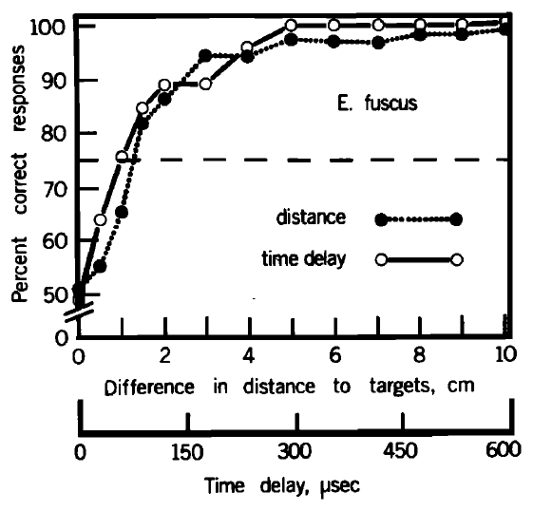
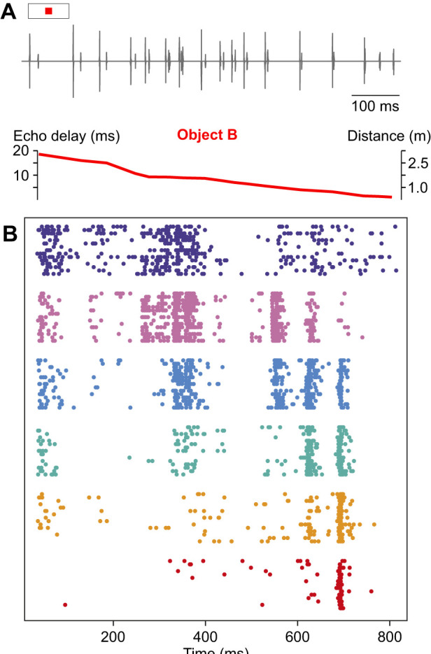
Echo arrival time can support the range judgment
Simmons compared physical-target discrimination with discrimination of electronically delayed echoes. In the simulator, the alternatives differed in arrival time rather than in the loudspeakers’ actual positions. The animal was still rewarded for selecting the echo corresponding to the nearer target.
At a simulated range of 30 cm, the electronic-delay and physical-distance performance curves were closely similar. Arrival-time differences corresponding to about 1 cm of range could be discriminated in the controlled feedback task. The figure retains both distance and delay scales.
Echo timing is therefore sufficient to mediate this relative-range judgment in big brown bats. The experiment does not imply that bats ignore spectral, directional, or intensity information in natural scenes; those variables were controlled here to isolate a particular ranging cue.
Simmons (1973), Fig. 13. Physical-range and electronic-delay discrimination at a 30-cm reference range.
Beetz et al. (2026), Fig. 2A–B. Echo delay over an approach sequence and color-coded cortical multi-unit rasters.
Simmons (1973); Beetz et al. (2026)
09
Notes:
• Simmons compared physical-target discrimination with discrimination of electronically delayed echoes. In the simulator, the alternatives differed in arrival time rather than in the loudspeakers’ actual positions. The animal was still rewarded for selecting the echo corresponding to the nearer target.
• At a simulated range of 30 cm, the electronic-delay and physical-distance performance curves were closely similar. Arrival-time differences corresponding to about 1 cm of range could be discriminated in the controlled feedback task. The figure retains both distance and delay scales.
• Echo timing is therefore sufficient to mediate this relative-range judgment in big brown bats. The experiment does not imply that bats ignore spectral, directional, or intensity information in natural scenes; those variables were controlled here to isolate a particular ranging cue.
• The comparison uses the same species and general task while changing how range is conveyed. Similar performance after this change is the evidence that arrival time can carry the required distance information.
References:
Simmons JA (1973). The resolution of target range by echolocating bats. Journal of the Acoustical Society of America 54(1):157–173. https://doi.org/10.1121/1.1913559
Beetz MJ, Kössl M, Hechavarría JC (2026). First come, first served: neuronal processing of multi-echo streams in the auditory cortex of echolocating bats. Journal of Experimental Biology 229(10):jeb252069. https://doi.org/10.1242/jeb.252069
Figure: Simmons (1973), Fig. 13. Physical-range and electronic-delay discrimination at a 30-cm reference range.
Figure source: https://doi.org/10.1121/1.1913559
Figure: Beetz et al. (2026), Fig. 2A–B. Echo delay over an approach sequence and color-coded cortical multi-unit rasters.
Figure source: https://doi.org/10.1242/jeb.252069

Slide 10
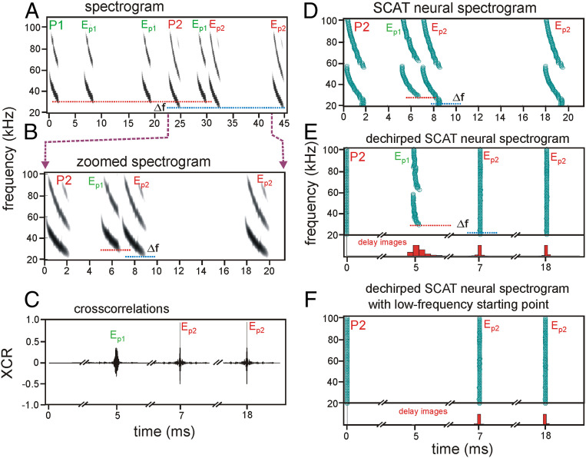
A matched receiver is a functional hypothesis
A matched receiver processes an incoming echo in relation to the structure of the transmitted signal. Cross-correlation measures similarity between two signals as their relative timing is varied. Simmons proposed a neural equivalent of this operation from the relationship between acoustic structure and behavioral resolution.
The measured range-discrimination curves resembled predictions based on the envelopes of recorded calls’ autocorrelation functions. The hypothesis concerns extraction of echo arrival time from a broadband signal rather than measurement of a single acoustic frequency.
The paper explicitly allowed neural representations distributed across frequency and time instead of literal waveform comparison. Behavioral agreement with a prediction supports a computational relationship, but it does not establish a permanent call template, a specific synaptic circuit, or direct neural copying of the acoustic waveform.
Simmons (1973), Fig. 3. Behavioral range resolution compared with the published receiver prediction.
Ming et al. (2020), Fig. 4. Spectrograms, cross-correlations and SCAT neural spectrograms for successive echoes.
Simmons (1973); Ming et al. (2020)
10
Notes:
• A matched receiver processes an incoming echo in relation to the structure of the transmitted signal. Cross-correlation measures similarity between two signals as their relative timing is varied. Simmons proposed a neural equivalent of this operation from the relationship between acoustic structure and behavioral resolution.
• The measured range-discrimination curves resembled predictions based on the envelopes of recorded calls’ autocorrelation functions. The hypothesis concerns extraction of echo arrival time from a broadband signal rather than measurement of a single acoustic frequency.
• The paper explicitly allowed neural representations distributed across frequency and time instead of literal waveform comparison. Behavioral agreement with a prediction supports a computational relationship, but it does not establish a permanent call template, a specific synaptic circuit, or direct neural copying of the acoustic waveform.
• Cross-correlation in the paper is a proposed functional description of the receiver. The distinction between a successful mathematical description and its biological implementation is essential when interpreting the behavioral curves.
References:
Simmons JA (1973). The resolution of target range by echolocating bats. Journal of the Acoustical Society of America 54(1):157–173. https://doi.org/10.1121/1.1913559
Ming C, Bates ME, Simmons JA (2020). How frequency hopping suppresses pulse-echo ambiguity in bat biosonar. Proceedings of the National Academy of Sciences 117(29):17288–17295. https://doi.org/10.1073/pnas.2001105117
Figure: Simmons (1973), Fig. 3. Behavioral range resolution compared with the published receiver prediction.
Figure source: https://doi.org/10.1121/1.1913559
Figure: Ming et al. (2020), Fig. 4. Spectrograms, cross-correlations and SCAT neural spectrograms for successive echoes.
Figure source: https://doi.org/10.1073/pnas.2001105117

Slide 11
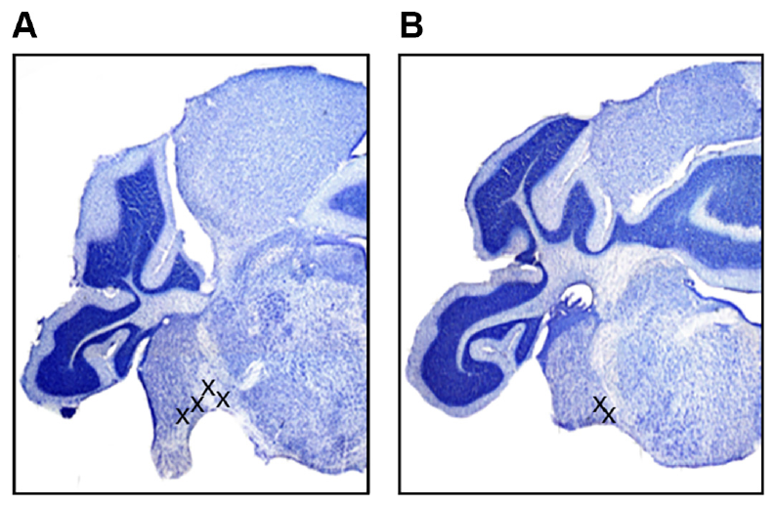
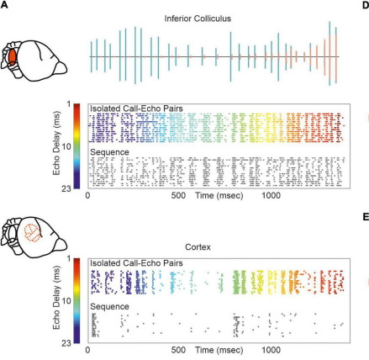
Timing is registered early in the auditory pathway
The cochlear nucleus is the first central relay receiving auditory-nerve input from the ear. The inferior colliculus is an auditory midbrain center receiving ascending inputs from brainstem nuclei. Simmons and colleagues compared population timing in these two structures in big brown bats.
Electrodes recorded in the ventral cochlear nucleus and inferior colliculus during anesthesia. Histological lesions identified cochlear-nucleus sites near the entry of the eighth cranial nerve and near the trapezoid body. The recovered positions restricted the anatomical interpretation of the recordings.
The comparison tested whether precise timing emerged only at the midbrain or was already present in an early relay. It sampled particular regions rather than every subdivision of the cochlear nucleus, so the findings cannot be assigned uniformly to all neurons or pathways in that structure.
Simmons et al. (2024), Fig. 2(A–B). Histological sections locating ventral cochlear-nucleus recordings.
Beetz & Hechavarría (2022), Fig. 5A. Inferior colliculus and cortex responses to call–echo pairs, color-coded by echo delay.
Simmons et al. (2024); Beetz & Hechavarría (2022)
11
Notes:
• The cochlear nucleus is the first central relay receiving auditory-nerve input from the ear. The inferior colliculus is an auditory midbrain center receiving ascending inputs from brainstem nuclei. Simmons and colleagues compared population timing in these two structures in big brown bats.
• Electrodes recorded in the ventral cochlear nucleus and inferior colliculus during anesthesia. Histological lesions identified cochlear-nucleus sites near the entry of the eighth cranial nerve and near the trapezoid body. The recovered positions restricted the anatomical interpretation of the recordings.
• The comparison tested whether precise timing emerged only at the midbrain or was already present in an early relay. It sampled particular regions rather than every subdivision of the cochlear nucleus, so the findings cannot be assigned uniformly to all neurons or pathways in that structure.
• The stained tissue establishes where the electrode had been placed. Recording location matters because the cochlear nucleus contains subdivisions with different cells and projection patterns, rather than one homogeneous population.
References:
Simmons AM, Warnecke M, Simmons JA (2024). Microseconds-level coding of echo delay in the auditory brainstem of an FM-echolocating bat. Journal of Neurophysiology 132(6):2012–2022. https://doi.org/10.1152/jn.00305.2024
Beetz MJ, Hechavarría JC (2022). Neural processing of naturalistic echolocation signals in bats. Frontiers in Neural Circuits 16:899370. https://doi.org/10.3389/fncir.2022.899370
Figure: Simmons et al. (2024), Fig. 2(A–B). Histological sections locating ventral cochlear-nucleus recordings.
Figure source: https://doi.org/10.1152/jn.00305.2024
Figure: Beetz & Hechavarría (2022), Fig. 5A. Inferior colliculus and cortex responses to call–echo pairs, color-coded by echo delay.
Figure source: https://doi.org/10.3389/fncir.2022.899370

Slide 12
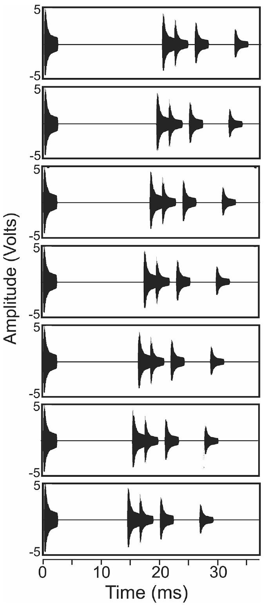
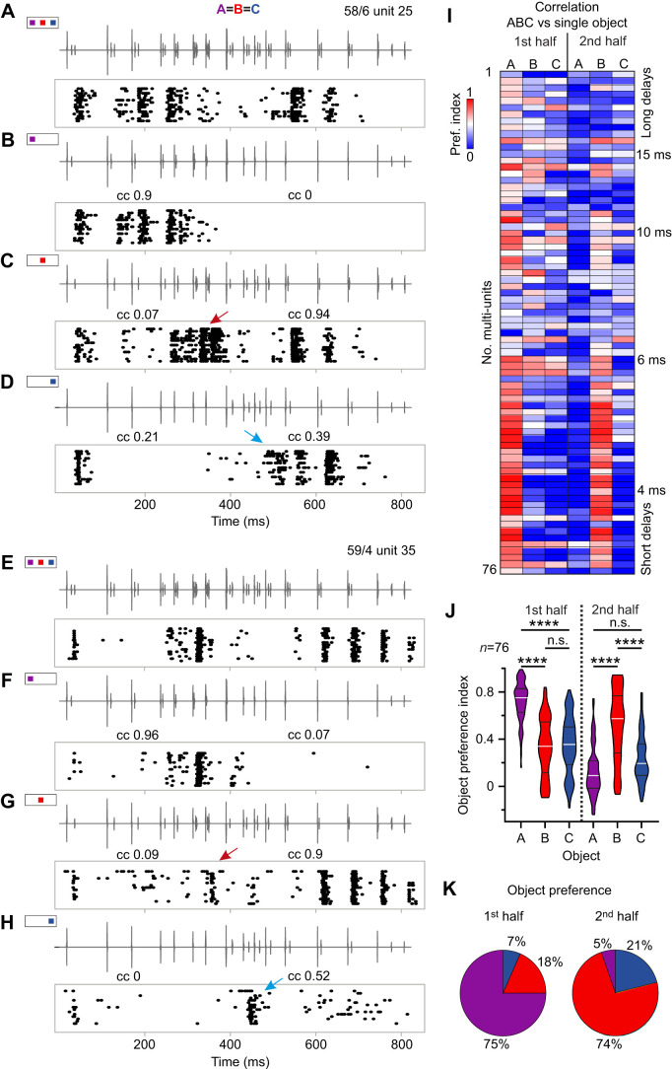
Echo cascades approximate a scene with several objects
An echo cascade is a sequence of reflections arriving after one broadcast. Simmons and colleagues constructed stimuli containing a 2.5-ms downward FM broadcast followed by four echoes with the same spectral content and different amplitudes. The stimulus approximated multiple reflectors near a flying bat.
The first echo arrived at delays from 20.4 to 14.4 ms in 1-ms steps. Subsequent echo intervals were 2.1, 3.5, and 6.8 ms. FM1 swept from 50 to 20 kHz and FM2 from 100 to 40 kHz.
Changing the first-echo delay altered the simulated scene while preserving its general cascade structure. This design tested timing during a sequence of echoes rather than an isolated tone. The anesthetized preparation did not measure ongoing vocal choice or obstacle-avoidance behavior.
Simmons et al. (2024), Fig. 1. Published broadcast–echo waveforms with first-echo delays from 20.4 to 14.4 ms.
Beetz et al. (2026), Fig. 3. Cortical responses to echo cascades from three objects and object preference indices.
Simmons et al. (2024); Beetz et al. (2026)
12
Notes:
• An echo cascade is a sequence of reflections arriving after one broadcast. Simmons and colleagues constructed stimuli containing a 2.5-ms downward FM broadcast followed by four echoes with the same spectral content and different amplitudes. The stimulus approximated multiple reflectors near a flying bat.
• The first echo arrived at delays from 20.4 to 14.4 ms in 1-ms steps. Subsequent echo intervals were 2.1, 3.5, and 6.8 ms. FM1 swept from 50 to 20 kHz and FM2 from 100 to 40 kHz.
• Changing the first-echo delay altered the simulated scene while preserving its general cascade structure. This design tested timing during a sequence of echoes rather than an isolated tone. The anesthetized preparation did not measure ongoing vocal choice or obstacle-avoidance behavior.
• Each plotted waveform begins with a broadcast and then contains four echoes. The series is a controlled acoustic approximation of approaching a set of reflectors, not a recording of a bat actually flying past those objects.
References:
Simmons AM, Warnecke M, Simmons JA (2024). Microseconds-level coding of echo delay in the auditory brainstem of an FM-echolocating bat. Journal of Neurophysiology 132(6):2012–2022. https://doi.org/10.1152/jn.00305.2024
Beetz MJ, Kössl M, Hechavarría JC (2026). First come, first served: neuronal processing of multi-echo streams in the auditory cortex of echolocating bats. Journal of Experimental Biology 229(10):jeb252069. https://doi.org/10.1242/jeb.252069
Figure: Simmons et al. (2024), Fig. 1. Published broadcast–echo waveforms with first-echo delays from 20.4 to 14.4 ms.
Figure source: https://doi.org/10.1152/jn.00305.2024
Figure: Beetz et al. (2026), Fig. 3. Cortical responses to echo cascades from three objects and object preference indices.
Figure source: https://doi.org/10.1242/jeb.252069

Slide 13
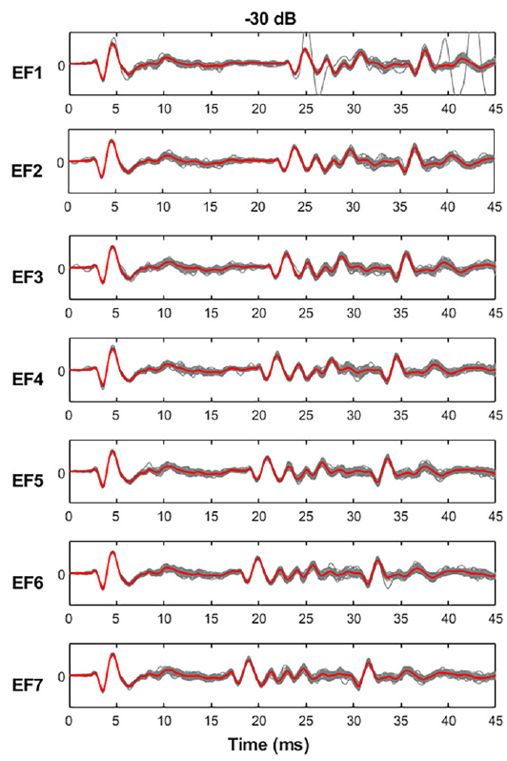
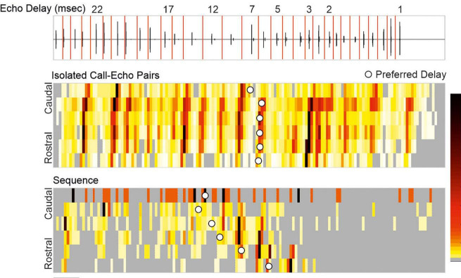
Population potentials register calls and echoes
A local field potential, or LFP, is an extracellular voltage signal reflecting coordinated activity in a neuronal population. Simmons and colleagues filtered recordings to examine low-frequency population waveforms rather than treating every deflection as a single neuron’s action potential.
In the cochlear nucleus, each broadcast and the first echo produced a prominent negative peak followed by a positive peak. Repeated presentations of the same echo-flow stimulus produced closely overlapping early responses. Later parts of the cascade had more variable waveforms.
The consistency of a population response provides a candidate timing signal for registering acoustic events. LFP timing does not identify the exact contributing cells, nor does it establish which downstream decoder reads the response. The measured signal combines neuronal activity within the electrode’s recording field.
Simmons et al. (2024), Fig. 3, left column. Repeated cochlear-nucleus responses at −30 dB attenuation.
Beetz & Hechavarría (2022), Fig. 3. Carollia auditory cortex activity across an approach sequence, caudal to rostral.
Simmons et al. (2024); Beetz & Hechavarría (2022)
13
Notes:
• A local field potential, or LFP, is an extracellular voltage signal reflecting coordinated activity in a neuronal population. Simmons and colleagues filtered recordings to examine low-frequency population waveforms rather than treating every deflection as a single neuron’s action potential.
• In the cochlear nucleus, each broadcast and the first echo produced a prominent negative peak followed by a positive peak. Repeated presentations of the same echo-flow stimulus produced closely overlapping early responses. Later parts of the cascade had more variable waveforms.
• The consistency of a population response provides a candidate timing signal for registering acoustic events. LFP timing does not identify the exact contributing cells, nor does it establish which downstream decoder reads the response. The measured signal combines neuronal activity within the electrode’s recording field.
• The early peaks can be measured repeatedly from the same population signal. A field-potential peak is not equivalent to a spike from one identified cell, so population timing and single-cell timing must remain distinct.
References:
Simmons AM, Warnecke M, Simmons JA (2024). Microseconds-level coding of echo delay in the auditory brainstem of an FM-echolocating bat. Journal of Neurophysiology 132(6):2012–2022. https://doi.org/10.1152/jn.00305.2024
Beetz MJ, Hechavarría JC (2022). Neural processing of naturalistic echolocation signals in bats. Frontiers in Neural Circuits 16:899370. https://doi.org/10.3389/fncir.2022.899370
Figure: Simmons et al. (2024), Fig. 3, left column. Repeated cochlear-nucleus responses at −30 dB attenuation.
Figure source: https://doi.org/10.1152/jn.00305.2024
Figure: Beetz & Hechavarría (2022), Fig. 3. Carollia auditory cortex activity across an approach sequence, caudal to rostral.
Figure source: https://doi.org/10.3389/fncir.2022.899370

Slide 14
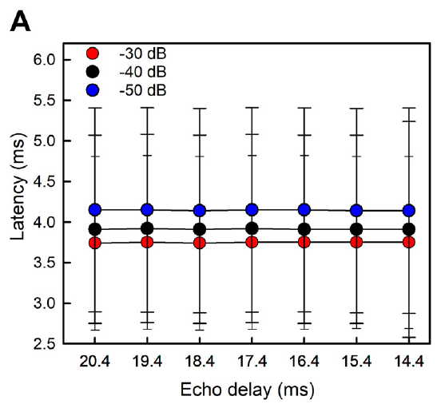
Broadcast latency changes with acoustic level
Response latency is the time from a stimulus event to a specified neural response. In the cochlear nucleus, Simmons and colleagues measured the first negative LFP peak after the broadcast. The event used for measurement was kept consistent across stimulus conditions.
Mean broadcast latencies were 3.7, 3.9, and 4.2 ms at attenuation settings of −30, −40, and −50 dB. Greater attenuation means a weaker presented sound. The broadcast’s latency remained similar when only the later echo delay changed.
Acoustic level can therefore shift the timing of an early population response even when the broadcast itself starts at the same time. A timing-based range code must accommodate level-dependent response delays rather than assuming that every sound onset produces a fixed neural latency.
Simmons et al. (2024), Fig. 4(A). Cochlear-nucleus broadcast latency at three attenuation settings.
Simmons et al. (2024)
14
Notes:
• Response latency is the time from a stimulus event to a specified neural response. In the cochlear nucleus, Simmons and colleagues measured the first negative LFP peak after the broadcast. The event used for measurement was kept consistent across stimulus conditions.
• Mean broadcast latencies were 3.7, 3.9, and 4.2 ms at attenuation settings of −30, −40, and −50 dB. Greater attenuation means a weaker presented sound. The broadcast’s latency remained similar when only the later echo delay changed.
• Acoustic level can therefore shift the timing of an early population response even when the broadcast itself starts at the same time. A timing-based range code must accommodate level-dependent response delays rather than assuming that every sound onset produces a fixed neural latency.
• The attenuation values are stimulus settings, not uncertainty terms. The broadcast remained the same event across the echo-flow series, while the first reflection moved earlier in time as simulated range decreased.
References:
Simmons AM, Warnecke M, Simmons JA (2024). Microseconds-level coding of echo delay in the auditory brainstem of an FM-echolocating bat. Journal of Neurophysiology 132(6):2012–2022. https://doi.org/10.1152/jn.00305.2024
Figure: Simmons et al. (2024), Fig. 4(A). Cochlear-nucleus broadcast latency at three attenuation settings.
Figure source: https://doi.org/10.1152/jn.00305.2024

Slide 15
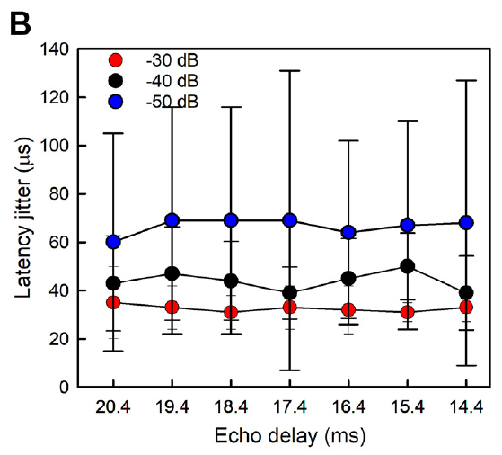
Broadcast timing varies by tens of microseconds
Latency jitter is the trial-to-trial spread in the timing of a defined neural response. A small jitter indicates that repeated sound presentations evoke that event at nearly the same time. It differs from the mean latency, which measures how long the response takes to arrive.
For the cochlear-nucleus broadcast peak, the paper reported mean jitter values of 32, 44, and 67 μs at −30, −40, and −50 dB attenuation. Timing became more variable as the stimulus weakened, while remaining comparatively stable across the seven later-echo delays.
Precision on this scale supports population timing as a potential component of echo processing. It is not the same as a behavioral threshold, and it does not demonstrate that each individual neuron in the recorded population has equally precise responses.
Simmons et al. (2024), Fig. 4(B). Cochlear-nucleus broadcast latency jitter in μs.
Simmons et al. (2024)
15
Notes:
• Latency jitter is the trial-to-trial spread in the timing of a defined neural response. A small jitter indicates that repeated sound presentations evoke that event at nearly the same time. It differs from the mean latency, which measures how long the response takes to arrive.
• For the cochlear-nucleus broadcast peak, the paper reported mean jitter values of 32, 44, and 67 μs at −30, −40, and −50 dB attenuation. Timing became more variable as the stimulus weakened, while remaining comparatively stable across the seven later-echo delays.
• Precision on this scale supports population timing as a potential component of echo processing. It is not the same as a behavioral threshold, and it does not demonstrate that each individual neuron in the recorded population has equally precise responses.
• A response may arrive several milliseconds after a sound and still be repeatable within tens of microseconds. Mean delay and repeatability describe different features of the signal and should not be conflated.
References:
Simmons AM, Warnecke M, Simmons JA (2024). Microseconds-level coding of echo delay in the auditory brainstem of an FM-echolocating bat. Journal of Neurophysiology 132(6):2012–2022. https://doi.org/10.1152/jn.00305.2024
Figure: Simmons et al. (2024), Fig. 4(B). Cochlear-nucleus broadcast latency jitter in μs.
Figure source: https://doi.org/10.1152/jn.00305.2024

Slide 16
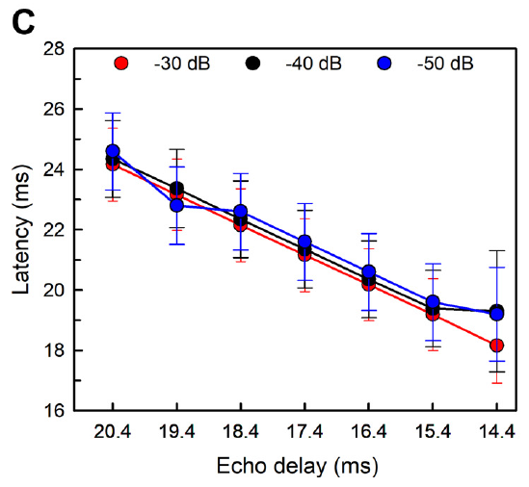
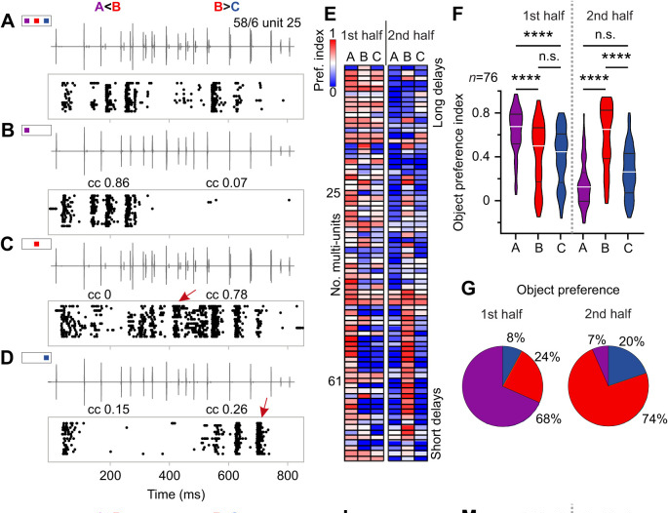
First-echo responses follow the changing delay
The first returning echo in the cascade moved earlier as the simulated target approached. Cochlear-nucleus response peaks consequently occurred earlier relative to the broadcast onset. The neural signal preserved the ordering of the seven experimentally imposed echo delays.
Simmons and colleagues also quantified amplitude–latency trading, the shift in response timing associated with a change in sound level. The first echo’s cochlear-nucleus response changed by about 18 μs per dB, while the corresponding broadcast measure was about 20 μs per dB.
Echo timing and echo strength thus influence the measured latency together. These are separable experimental relationships, but they coexist in the auditory signal. The result supports accurate registration of relative timing while showing that response latency is not an uncorrected acoustic timestamp independent of level.
Simmons et al. (2024), Fig. 4(C). First-echo latency tracks experimentally shortened echo delay.
Beetz et al. (2026), Fig. 6A–G. Cortical units respond mainly to the first echo of a cascade at differing echo levels.
Simmons et al. (2024); Beetz et al. (2026)
16
Notes:
• The first returning echo in the cascade moved earlier as the simulated target approached. Cochlear-nucleus response peaks consequently occurred earlier relative to the broadcast onset. The neural signal preserved the ordering of the seven experimentally imposed echo delays.
• Simmons and colleagues also quantified amplitude–latency trading, the shift in response timing associated with a change in sound level. The first echo’s cochlear-nucleus response changed by about 18 μs per dB, while the corresponding broadcast measure was about 20 μs per dB.
• Echo timing and echo strength thus influence the measured latency together. These are separable experimental relationships, but they coexist in the auditory signal. The result supports accurate registration of relative timing while showing that response latency is not an uncorrected acoustic timestamp independent of level.
• A weaker sound can evoke a later neural response even if its physical arrival time is unchanged. This level effect is distinct from moving the echo itself earlier in the controlled stimulus sequence.
References:
Simmons AM, Warnecke M, Simmons JA (2024). Microseconds-level coding of echo delay in the auditory brainstem of an FM-echolocating bat. Journal of Neurophysiology 132(6):2012–2022. https://doi.org/10.1152/jn.00305.2024
Beetz MJ, Kössl M, Hechavarría JC (2026). First come, first served: neuronal processing of multi-echo streams in the auditory cortex of echolocating bats. Journal of Experimental Biology 229(10):jeb252069. https://doi.org/10.1242/jeb.252069
Figure: Simmons et al. (2024), Fig. 4(C). First-echo latency tracks experimentally shortened echo delay.
Figure source: https://doi.org/10.1152/jn.00305.2024
Figure: Beetz et al. (2026), Fig. 6A–G. Cortical units respond mainly to the first echo of a cascade at differing echo levels.
Figure source: https://doi.org/10.1242/jeb.252069

Slide 17
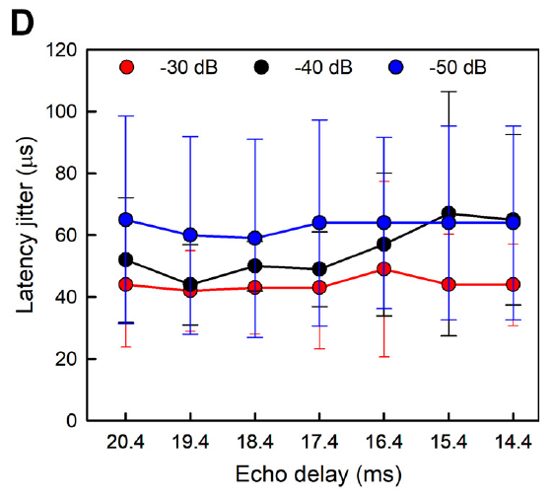
First-echo jitter is stable across the tested delays
Simmons and colleagues compared trial-to-trial timing precision of the first-echo response across delays from 20.4 to 14.4 ms. The cochlear-nucleus peak shifted with acoustic delay, but its repeatability remained relatively stable across that tested range.
Mean jitter values for this peak were 44, 50, and 63 μs at the three attenuation levels. The overall value was about 54 μs. Weaker stimuli increased the variability, so stability across echo delays did not imply complete independence from all acoustic variables.
The result separates the representation of a moving event from the precision of that representation. It applies to a prominent population-response peak in the ventral cochlear nucleus under anesthesia. It does not identify an individual neuron tuned exclusively to a particular target distance.
Simmons et al. (2024), Fig. 4(D). First-echo latency jitter at seven delays and three sound levels.
Simmons et al. (2024)
17
Notes:
• Simmons and colleagues compared trial-to-trial timing precision of the first-echo response across delays from 20.4 to 14.4 ms. The cochlear-nucleus peak shifted with acoustic delay, but its repeatability remained relatively stable across that tested range.
• Mean jitter values for this peak were 44, 50, and 63 μs at the three attenuation levels. The overall value was about 54 μs. Weaker stimuli increased the variability, so stability across echo delays did not imply complete independence from all acoustic variables.
• The result separates the representation of a moving event from the precision of that representation. It applies to a prominent population-response peak in the ventral cochlear nucleus under anesthesia. It does not identify an individual neuron tuned exclusively to a particular target distance.
• Delay selectivity and response-time precision are different measurements. A precise onset response may register many successive delays without having a sharply peaked preference for only one of them.
References:
Simmons AM, Warnecke M, Simmons JA (2024). Microseconds-level coding of echo delay in the auditory brainstem of an FM-echolocating bat. Journal of Neurophysiology 132(6):2012–2022. https://doi.org/10.1152/jn.00305.2024
Figure: Simmons et al. (2024), Fig. 4(D). First-echo latency jitter at seven delays and three sound levels.
Figure source: https://doi.org/10.1152/jn.00305.2024

Slide 18
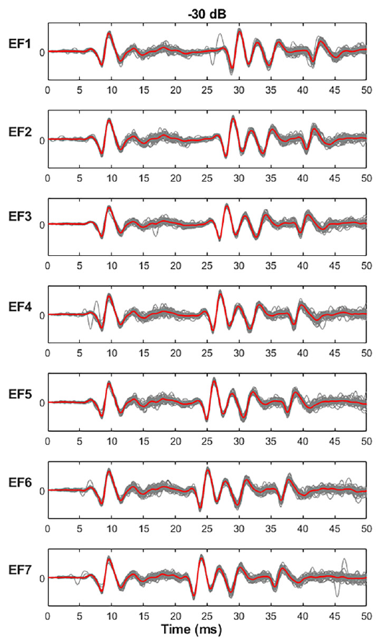
Midbrain responses retain precise onset timing
The inferior colliculus integrates ascending auditory information from multiple brainstem pathways. Simmons and colleagues reanalyzed midbrain LFPs from the same animals used for the cochlear-nucleus comparison, applying the same echo-flow stimuli and timing measurements.
Broadcast responses in the inferior colliculus had mean latencies of 6.7, 7.0, and 7.5 ms at the three attenuation levels. These values were longer than cochlear-nucleus latencies, consistent with additional processing before a midbrain response. Early broadcast and echo peaks remained closely aligned across repetitions.
A later mean response need not have poorer temporal precision. The study measured propagation and repeatability separately. The recordings support retention of precise population timing at the midbrain, while leaving the responsible cells and contributions of parallel ascending inputs unresolved.
Simmons et al. (2024), Fig. 5, left column. Repeated inferior-colliculus responses at −30 dB attenuation.
Simmons et al. (2024)
18
Notes:
• The inferior colliculus integrates ascending auditory information from multiple brainstem pathways. Simmons and colleagues reanalyzed midbrain LFPs from the same animals used for the cochlear-nucleus comparison, applying the same echo-flow stimuli and timing measurements.
• Broadcast responses in the inferior colliculus had mean latencies of 6.7, 7.0, and 7.5 ms at the three attenuation levels. These values were longer than cochlear-nucleus latencies, consistent with additional processing before a midbrain response. Early broadcast and echo peaks remained closely aligned across repetitions.
• A later mean response need not have poorer temporal precision. The study measured propagation and repeatability separately. The recordings support retention of precise population timing at the midbrain, while leaving the responsible cells and contributions of parallel ascending inputs unresolved.
• The added latency is the time required before a midbrain response occurs. The waveform’s consistency across repetitions is a separate property, so additional processing time does not by itself imply a loss of timing precision.
References:
Simmons AM, Warnecke M, Simmons JA (2024). Microseconds-level coding of echo delay in the auditory brainstem of an FM-echolocating bat. Journal of Neurophysiology 132(6):2012–2022. https://doi.org/10.1152/jn.00305.2024
Figure: Simmons et al. (2024), Fig. 5, left column. Repeated inferior-colliculus responses at −30 dB attenuation.
Figure source: https://doi.org/10.1152/jn.00305.2024

Slide 19
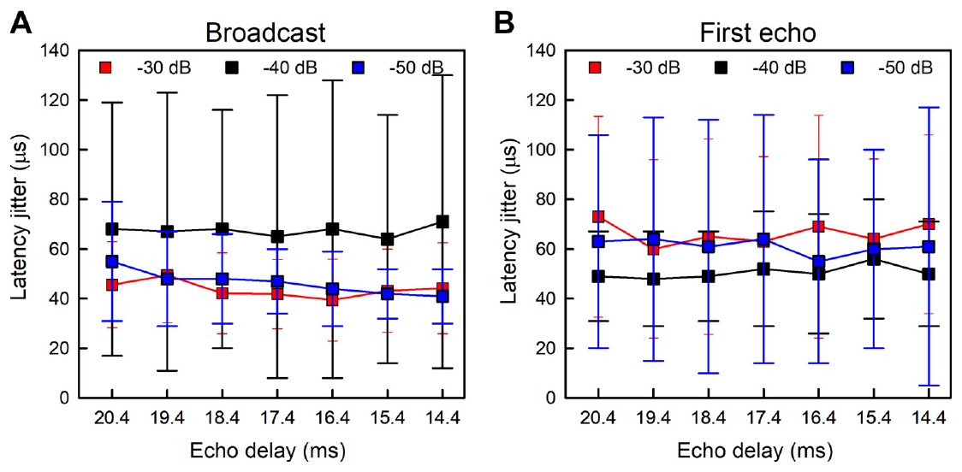
Timing is similarly precise in two auditory relays
Simmons and colleagues found mean inferior-colliculus jitter values of about 52 μs for the broadcast and 59 μs for the first echo. These were similar to the corresponding cochlear-nucleus values of approximately 48 and 54 μs.
The comparison provides little evidence that timing precision was dramatically sharpened between these sampled early and midbrain populations. It is consistent with precise timing already entering the ascending pathway and being preserved. The result does not require identical response latencies at the two relays.
This inference concerns the recorded LFP events, not every neural feature in the pathway. Other regions or response measures could undergo additional transformations. A similarity between two population measurements cannot identify the anatomical projection carrying all of the precise timing information.
Simmons et al. (2024), Fig. 6(A–B). Midbrain latency jitter for broadcast and first-echo responses.
Simmons et al. (2024)
19
Notes:
• Simmons and colleagues found mean inferior-colliculus jitter values of about 52 μs for the broadcast and 59 μs for the first echo. These were similar to the corresponding cochlear-nucleus values of approximately 48 and 54 μs.
• The comparison provides little evidence that timing precision was dramatically sharpened between these sampled early and midbrain populations. It is consistent with precise timing already entering the ascending pathway and being preserved. The result does not require identical response latencies at the two relays.
• This inference concerns the recorded LFP events, not every neural feature in the pathway. Other regions or response measures could undergo additional transformations. A similarity between two population measurements cannot identify the anatomical projection carrying all of the precise timing information.
• The data compare response variability, not just the time of each peak. The cochlear nucleus responded earlier than the inferior colliculus, but the variability in the early response was of a similar order at both locations.
References:
Simmons AM, Warnecke M, Simmons JA (2024). Microseconds-level coding of echo delay in the auditory brainstem of an FM-echolocating bat. Journal of Neurophysiology 132(6):2012–2022. https://doi.org/10.1152/jn.00305.2024
Figure: Simmons et al. (2024), Fig. 6(A–B). Midbrain latency jitter for broadcast and first-echo responses.
Figure source: https://doi.org/10.1152/jn.00305.2024

Slide 20
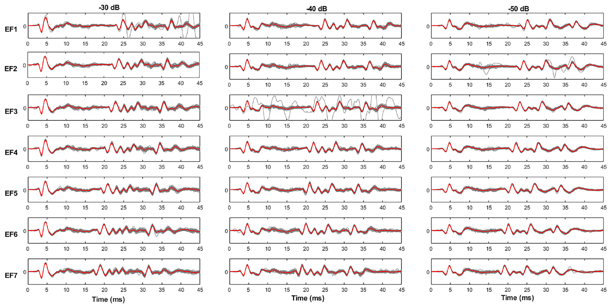
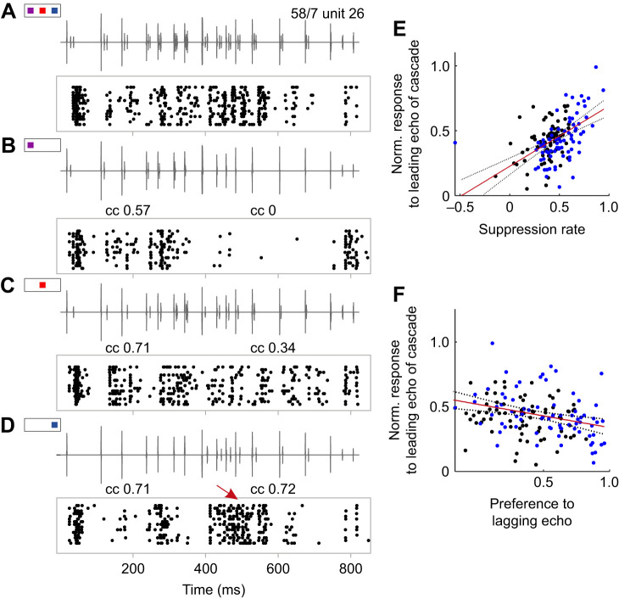
Later echoes have more variable population responses
A broadcast followed by several reflections recruits an evolving auditory response rather than four independent copies of one onset event. Simmons and colleagues measured prominent positive LFP peaks throughout the four-echo cascade as well as the early negative peak.
Cochlear-nucleus timing variability for the later positive peaks was around 124 μs across the cascade, and the comparable inferior-colliculus value was about 111 μs. These values were larger than the tens-of-microseconds jitter of the earliest negative peaks, while remaining below a millisecond.
The authors linked the increased variability to recruitment of additional neurons during the extended sequence. That account is an interpretation of population waveforms, rather than direct identification of every recruited cell. Precision depends on which event and which portion of a response are measured.
Simmons et al. (2024), Fig. 3. Cochlear-nucleus responses throughout the seven echo-flow sequences.
Beetz et al. (2026), Fig. 5. Response to the leading echo against suppression of the lagging echo.
Simmons et al. (2024); Beetz et al. (2026)
20
Notes:
• A broadcast followed by several reflections recruits an evolving auditory response rather than four independent copies of one onset event. Simmons and colleagues measured prominent positive LFP peaks throughout the four-echo cascade as well as the early negative peak.
• Cochlear-nucleus timing variability for the later positive peaks was around 124 μs across the cascade, and the comparable inferior-colliculus value was about 111 μs. These values were larger than the tens-of-microseconds jitter of the earliest negative peaks, while remaining below a millisecond.
• The authors linked the increased variability to recruitment of additional neurons during the extended sequence. That account is an interpretation of population waveforms, rather than direct identification of every recruited cell. Precision depends on which event and which portion of a response are measured.
• The earliest negative response and the later positive peaks are distinct events in the same field potential. Their different variability prevents one number from describing every part of the auditory response.
References:
Simmons AM, Warnecke M, Simmons JA (2024). Microseconds-level coding of echo delay in the auditory brainstem of an FM-echolocating bat. Journal of Neurophysiology 132(6):2012–2022. https://doi.org/10.1152/jn.00305.2024
Beetz MJ, Kössl M, Hechavarría JC (2026). First come, first served: neuronal processing of multi-echo streams in the auditory cortex of echolocating bats. Journal of Experimental Biology 229(10):jeb252069. https://doi.org/10.1242/jeb.252069
Figure: Simmons et al. (2024), Fig. 3. Cochlear-nucleus responses throughout the seven echo-flow sequences.
Figure source: https://doi.org/10.1152/jn.00305.2024
Figure: Beetz et al. (2026), Fig. 5. Response to the leading echo against suppression of the lagging echo.
Figure source: https://doi.org/10.1242/jeb.252069

Slide 21
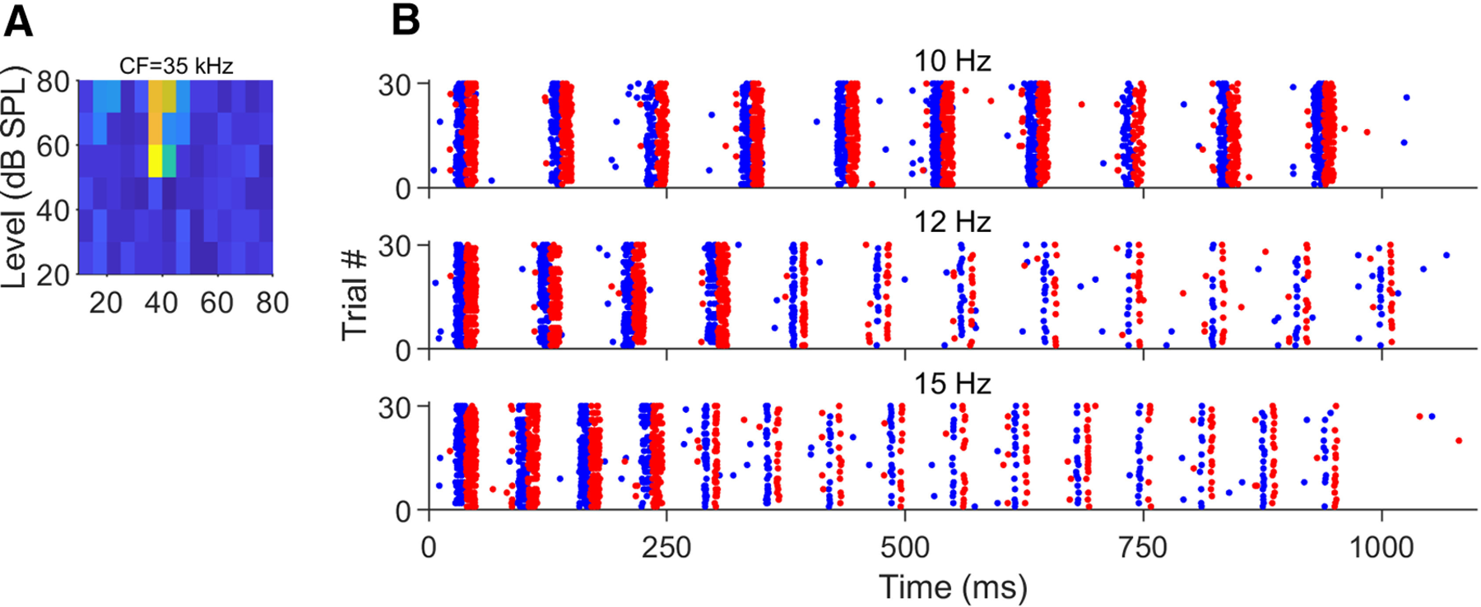
Measured brainstem precision leaves a perceptual gap
The 2024 study discusses behavioral echo-delay acuity reaching approximately 1 μs or less in specialized psychophysical tasks. Its population-response jitter values were usually tens of microseconds. Neural repeatability approached this behavioral scale without reaching it.
The authors proposed that precisely timed population signals contribute to the eventual range computation. Combining information across frequencies and responses could improve a readout, but the experiment did not directly identify such a decoder or measure its achieved precision.
The temporal sampling and restricted recording sites also limit interpretation. A 20-kHz digitization rate places important constraints on very small timing estimates. The established finding is precise early and midbrain population activity; the complete mechanism of perceptual hyperacuity remains unresolved.
Macías et al. (2022), Fig. 3A–B. Tadarida cortical neuron: tuning and spike rasters to pulse–echo trains at 10–15 Hz.
Simmons et al. (2024); Macías et al. (2022)
21
Notes:
• The 2024 study discusses behavioral echo-delay acuity reaching approximately 1 μs or less in specialized psychophysical tasks. Its population-response jitter values were usually tens of microseconds. Neural repeatability approached this behavioral scale without reaching it.
• The authors proposed that precisely timed population signals contribute to the eventual range computation. Combining information across frequencies and responses could improve a readout, but the experiment did not directly identify such a decoder or measure its achieved precision.
• The temporal sampling and restricted recording sites also limit interpretation. A 20-kHz digitization rate places important constraints on very small timing estimates. The established finding is precise early and midbrain population activity; the complete mechanism of perceptual hyperacuity remains unresolved.
• The behavioral threshold and neural measurement came from different tasks and preparations. The brainstem data cannot be described as a complete explanation of one-microsecond perception, because the observed variability remained larger and the decoder was not tested.
References:
Simmons AM, Warnecke M, Simmons JA (2024). Microseconds-level coding of echo delay in the auditory brainstem of an FM-echolocating bat. Journal of Neurophysiology 132(6):2012–2022. https://doi.org/10.1152/jn.00305.2024
Macías S, Bakshi K, Smotherman M (2022). Faster repetition rate sharpens the cortical representation of echo streams in echolocating bats. eNeuro 9(1):ENEURO.0410-21.2021. https://doi.org/10.1523/ENEURO.0410-21.2021
Figure: Macías et al. (2022), Fig. 3A–B. Tadarida cortical neuron: tuning and spike rasters to pulse–echo trains at 10–15 Hz.
Figure source: https://doi.org/10.1523/ENEURO.0410-21.2021

Slide 22
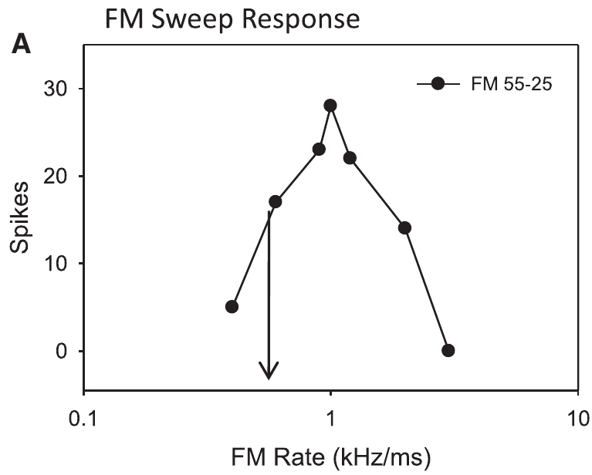
Pallid-bat midbrain neurons select downward sweeps
Sweep direction selectivity is a difference in neuronal response to upward and downward frequency changes. Williams and Fuzessery studied this property in the inferior colliculus of the pallid bat, Antrozous pallidus, whose echolocation call sweeps downward approximately from 60 to 30 kHz.
Extracellular electrodes recorded individual neurons in the high-frequency midbrain region. Broad sweeps were presented over durations from 0.5 to 100 ms, allowing direction and sweep rate, the frequency change per unit time, to vary. Responses were measured near the neuron’s auditory threshold.
Many recorded neurons responded strongly to downward sweeps and weakly to upward sweeps. The experiment isolated inhibitory-sideband mechanisms; neurons whose selectivity depended on duration tuning or asymmetrical facilitation were excluded. Its conclusions therefore concern a defined subset of FM-sensitive neurons.
Williams & Fuzessery (2011), Fig. 2(A). A pallid-bat neuron’s response depends on FM sweep rate.
Williams & Fuzessery (2011)
22
Notes:
• Sweep direction selectivity is a difference in neuronal response to upward and downward frequency changes. Williams and Fuzessery studied this property in the inferior colliculus of the pallid bat, Antrozous pallidus, whose echolocation call sweeps downward approximately from 60 to 30 kHz.
• Extracellular electrodes recorded individual neurons in the high-frequency midbrain region. Broad sweeps were presented over durations from 0.5 to 100 ms, allowing direction and sweep rate, the frequency change per unit time, to vary. Responses were measured near the neuron’s auditory threshold.
• Many recorded neurons responded strongly to downward sweeps and weakly to upward sweeps. The experiment isolated inhibitory-sideband mechanisms; neurons whose selectivity depended on duration tuning or asymmetrical facilitation were excluded. Its conclusions therefore concern a defined subset of FM-sensitive neurons.
• The pallid bat is a different species from the big brown bat used in the ranging experiments. Its midbrain recordings provide evidence about FM feature processing, not a direct behavioral test of big brown bat range perception.
References:
Williams AJ, Fuzessery ZM (2011). Differential roles of GABAergic and glycinergic input on FM selectivity in the inferior colliculus of the pallid bat. Journal of Neurophysiology 106(5):2523–2535. https://doi.org/10.1152/jn.00569.2011
Figure: Williams & Fuzessery (2011), Fig. 2(A). A pallid-bat neuron’s response depends on FM sweep rate.
Figure source: https://doi.org/10.1152/jn.00569.2011

Slide 23
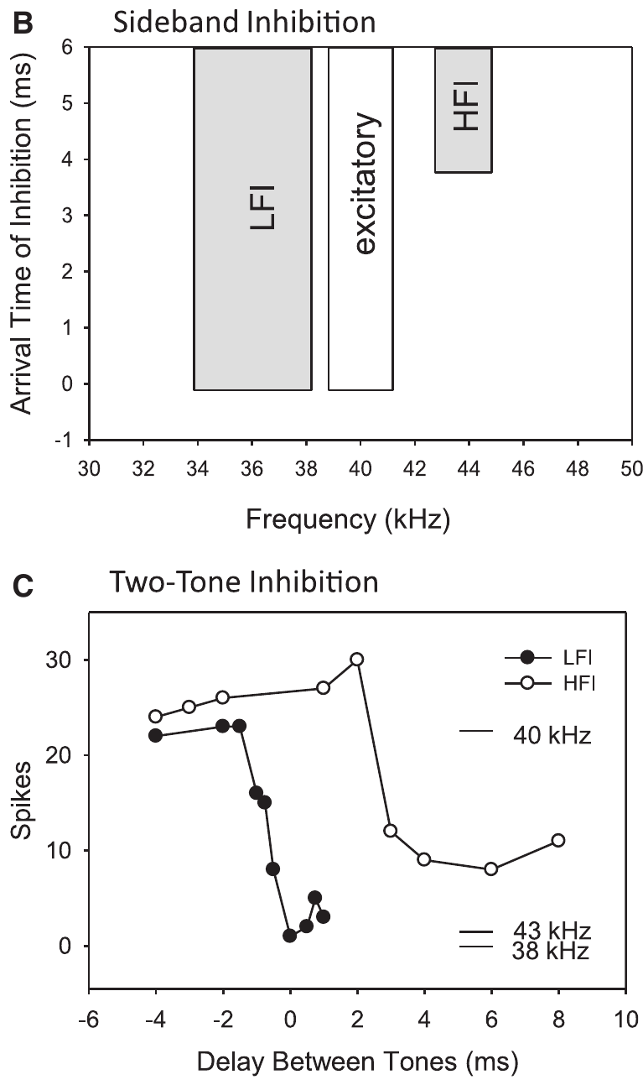
Inhibitory sidebands flank the excitatory band
An excitatory frequency band contains sounds that evoke a neuron’s spikes. An inhibitory sideband contains frequencies that suppress an otherwise effective response. The inhibitory frequencies need not produce a visible excitatory response when presented alone.
Williams and Fuzessery mapped sidebands on either side of a neuron’s preferred frequencies using pairs of tones. Low-frequency inhibition, or LFI, generally arrived early relative to excitation. High-frequency inhibition, or HFI, generally arrived later and could suppress slow downward sweeps.
A sweep crosses these frequency regions in an ordered sequence. Reversing sweep direction changes when the inhibitory and excitatory inputs are activated. Changing sweep rate alters the time between them. Frequency tuning and relative input timing therefore interact to select particular FM sounds.
Williams & Fuzessery (2011), Fig. 2(B–C). Frequency-sideband organization and two-tone suppression timing.
Williams & Fuzessery (2011)
23
Notes:
• An excitatory frequency band contains sounds that evoke a neuron’s spikes. An inhibitory sideband contains frequencies that suppress an otherwise effective response. The inhibitory frequencies need not produce a visible excitatory response when presented alone.
• Williams and Fuzessery mapped sidebands on either side of a neuron’s preferred frequencies using pairs of tones. Low-frequency inhibition, or LFI, generally arrived early relative to excitation. High-frequency inhibition, or HFI, generally arrived later and could suppress slow downward sweeps.
• A sweep crosses these frequency regions in an ordered sequence. Reversing sweep direction changes when the inhibitory and excitatory inputs are activated. Changing sweep rate alters the time between them. Frequency tuning and relative input timing therefore interact to select particular FM sounds.
• An inhibitory sideband is defined functionally by suppression of a response to another sound. The two-tone test reveals suppression that would be missed by recording only the response to isolated tones.
References:
Williams AJ, Fuzessery ZM (2011). Differential roles of GABAergic and glycinergic input on FM selectivity in the inferior colliculus of the pallid bat. Journal of Neurophysiology 106(5):2523–2535. https://doi.org/10.1152/jn.00569.2011
Figure: Williams & Fuzessery (2011), Fig. 2(B–C). Frequency-sideband organization and two-tone suppression timing.
Figure source: https://doi.org/10.1152/jn.00569.2011

Slide 24
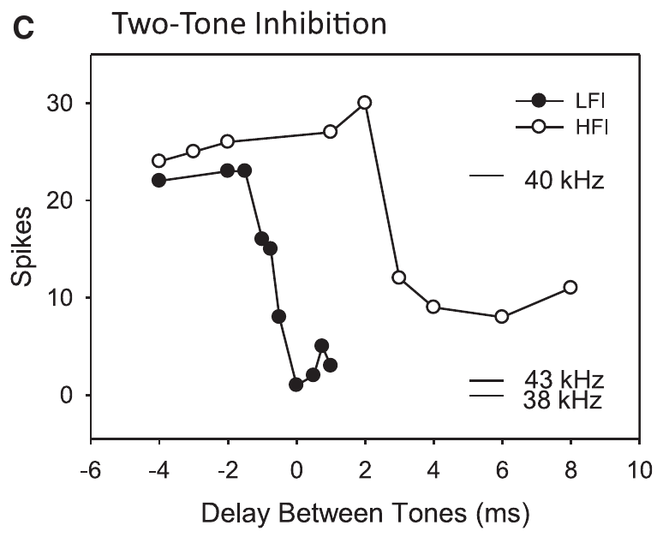
Two-tone tests measure relative inhibitory arrival
Williams and Fuzessery paired a 5-ms excitatory tone with a 20-ms tone in an inhibitory sideband. They varied the interval between the tones and measured how much the neuron’s response to the excitatory sound was reduced.
Suppression despite a later inhibitory-tone onset indicates that the inhibitory pathway can act sooner than the excitatory pathway. If the inhibitory sound must begin earlier, its effect arrives relatively late. The measured quantity is a functional timing relationship, not a direct recording of a synaptic current.
This two-tone inhibition method predicted which frequency sequences would be suppressed. A low-frequency tone with early inhibitory action can block an upward sweep before it reaches excitation. A high-frequency tone with delayed action can preferentially block a slow downward sweep.
Williams & Fuzessery (2011), Fig. 2(C). Suppression varies with the interval between excitatory and inhibitory tones.
Williams & Fuzessery (2011)
24
Notes:
• Williams and Fuzessery paired a 5-ms excitatory tone with a 20-ms tone in an inhibitory sideband. They varied the interval between the tones and measured how much the neuron’s response to the excitatory sound was reduced.
• Suppression despite a later inhibitory-tone onset indicates that the inhibitory pathway can act sooner than the excitatory pathway. If the inhibitory sound must begin earlier, its effect arrives relatively late. The measured quantity is a functional timing relationship, not a direct recording of a synaptic current.
• This two-tone inhibition method predicted which frequency sequences would be suppressed. A low-frequency tone with early inhibitory action can block an upward sweep before it reaches excitation. A high-frequency tone with delayed action can preferentially block a slow downward sweep.
• The experiment changes acoustic timing to infer when inhibition becomes effective at the recorded neuron. It does not expose the complete anatomical route or measure the transmitter release time at every intervening synapse.
References:
Williams AJ, Fuzessery ZM (2011). Differential roles of GABAergic and glycinergic input on FM selectivity in the inferior colliculus of the pallid bat. Journal of Neurophysiology 106(5):2523–2535. https://doi.org/10.1152/jn.00569.2011
Figure: Williams & Fuzessery (2011), Fig. 2(C). Suppression varies with the interval between excitatory and inhibitory tones.
Figure source: https://doi.org/10.1152/jn.00569.2011

Slide 25
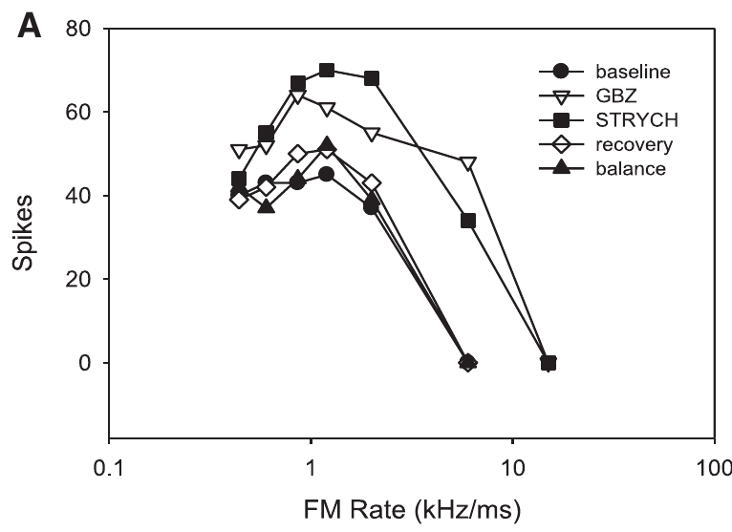
Receptor blockers test local inhibitory inputs
GABA and glycine are inhibitory neurotransmitters in the auditory pathways studied here. Their ionotropic GABA_A and glycine receptors mediate inhibitory membrane conductances. Gabazine blocks GABA_A receptors; strychnine blocks glycine receptors, permitting tests of each input’s contribution.
Williams and Fuzessery delivered the blockers near recorded neurons by microiontophoresis, movement of drug from a small pipette using electrical current. They compared baseline, drug application, and recovery. A balance-electrode current control tested whether current alone changed the response.
Responses commonly increased during receptor blockade and returned toward baseline after application stopped, typically over 10–30 minutes. These controls support a receptor-dependent local effect. Increased firing alone does not establish loss of selectivity; responses to different sweep directions and rates must also be compared.
Williams & Fuzessery (2011), Fig. 1(A). Responses during baseline, receptor blockade, recovery, and current control.
Williams & Fuzessery (2011)
25
Notes:
• GABA and glycine are inhibitory neurotransmitters in the auditory pathways studied here. Their ionotropic GABAA and glycine receptors mediate inhibitory membrane conductances. Gabazine blocks GABAA receptors; strychnine blocks glycine receptors, permitting tests of each input’s contribution.
• Williams and Fuzessery delivered the blockers near recorded neurons by microiontophoresis, movement of drug from a small pipette using electrical current. They compared baseline, drug application, and recovery. A balance-electrode current control tested whether current alone changed the response.
• Responses commonly increased during receptor blockade and returned toward baseline after application stopped, typically over 10–30 minutes. These controls support a receptor-dependent local effect. Increased firing alone does not establish loss of selectivity; responses to different sweep directions and rates must also be compared.
• Opening an inhibitory receptor’s ion channel changes the membrane conductance and reduces the effectiveness of excitation under these conditions. Blocking that receptor removes its local contribution, while other inhibitory inputs or inherited tuning can remain.
References:
Williams AJ, Fuzessery ZM (2011). Differential roles of GABAergic and glycinergic input on FM selectivity in the inferior colliculus of the pallid bat. Journal of Neurophysiology 106(5):2523–2535. https://doi.org/10.1152/jn.00569.2011
Figure: Williams & Fuzessery (2011), Fig. 1(A). Responses during baseline, receptor blockade, recovery, and current control.
Figure source: https://doi.org/10.1152/jn.00569.2011

Slide 26
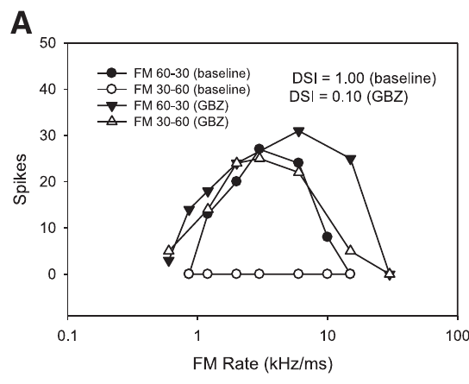
Blocking inhibition can admit upward FM responses
Downward-selective neurons normally responded weakly to upward sweeps even when the sweeps crossed the excitatory band. After local GABA_A or glycine receptor blockade, many neurons produced stronger upward-sweep responses and lost much of their direction selectivity.
Williams and Fuzessery compared both directions across sweep rates, rather than inferring selectivity from the response to one sound. Gabazine and strychnine could each reduce the preference for downward sweeps. Combined application removed the preference in an even larger fraction of the tested neurons.
The appearance of responses to previously ineffective upward sweeps supports a role for local inhibition in creating or refining direction selectivity. The result does not imply that every direction-selective neuron depends on both receptor classes or that all FM selectivity originates in the inferior colliculus.
Williams & Fuzessery (2011), Fig. 3(A). Gabazine alters responses to upward and downward FM sweeps.
Williams & Fuzessery (2011)
26
Notes:
• Downward-selective neurons normally responded weakly to upward sweeps even when the sweeps crossed the excitatory band. After local GABAA or glycine receptor blockade, many neurons produced stronger upward-sweep responses and lost much of their direction selectivity.
• Williams and Fuzessery compared both directions across sweep rates, rather than inferring selectivity from the response to one sound. Gabazine and strychnine could each reduce the preference for downward sweeps. Combined application removed the preference in an even larger fraction of the tested neurons.
• The appearance of responses to previously ineffective upward sweeps supports a role for local inhibition in creating or refining direction selectivity. The result does not imply that every direction-selective neuron depends on both receptor classes or that all FM selectivity originates in the inferior colliculus.
• Removing inhibition can change which sounds evoke spikes, not just increase the total spike count. A neuron that begins responding to upward sweeps has changed its stimulus preference even if its downward response also increases.
References:
Williams AJ, Fuzessery ZM (2011). Differential roles of GABAergic and glycinergic input on FM selectivity in the inferior colliculus of the pallid bat. Journal of Neurophysiology 106(5):2523–2535. https://doi.org/10.1152/jn.00569.2011
Figure: Williams & Fuzessery (2011), Fig. 3(A). Gabazine alters responses to upward and downward FM sweeps.
Figure source: https://doi.org/10.1152/jn.00569.2011

Slide 27
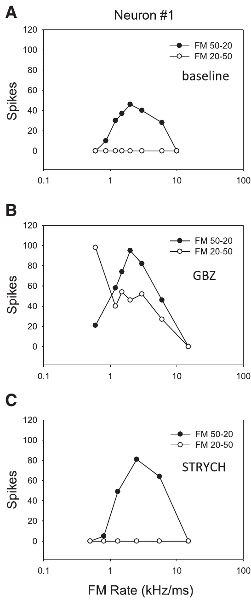
Neurons depend on different inhibitory inputs
Williams and Fuzessery applied gabazine and strychnine separately to the same neurons. This within-neuron comparison tested whether an apparent population similarity concealed differences in the receptor pathways supporting individual neurons’ preferences.
In one published example, gabazine removed direction selectivity whereas strychnine did not. Other examples showed the reverse pattern or sensitivity to either blocker. Baseline direction preference was therefore compatible with several inhibitory-input arrangements rather than one uniform transmitter mechanism.
The measurements identify functional dependence on receptor classes at the recording site. They do not identify every presynaptic source or establish that receptor distribution alone determines selectivity. Spectral position and relative timing of the inhibitory input also influence whether that input can suppress a sweep.
Williams & Fuzessery (2011), Fig. 4(A–C). One neuron loses direction selectivity with gabazine but retains it with strychnine.
Williams & Fuzessery (2011)
27
Notes:
• Williams and Fuzessery applied gabazine and strychnine separately to the same neurons. This within-neuron comparison tested whether an apparent population similarity concealed differences in the receptor pathways supporting individual neurons’ preferences.
• In one published example, gabazine removed direction selectivity whereas strychnine did not. Other examples showed the reverse pattern or sensitivity to either blocker. Baseline direction preference was therefore compatible with several inhibitory-input arrangements rather than one uniform transmitter mechanism.
• The measurements identify functional dependence on receptor classes at the recording site. They do not identify every presynaptic source or establish that receptor distribution alone determines selectivity. Spectral position and relative timing of the inhibitory input also influence whether that input can suppress a sweep.
• The three conditions were obtained from the same neuron, so differences between blockers cannot be attributed simply to sampling different neurons. A remaining direction preference after one drug means that the blocked pathway was not essential by itself.
References:
Williams AJ, Fuzessery ZM (2011). Differential roles of GABAergic and glycinergic input on FM selectivity in the inferior colliculus of the pallid bat. Journal of Neurophysiology 106(5):2523–2535. https://doi.org/10.1152/jn.00569.2011
Figure: Williams & Fuzessery (2011), Fig. 4(A–C). One neuron loses direction selectivity with gabazine but retains it with strychnine.
Figure source: https://doi.org/10.1152/jn.00569.2011

Slide 28
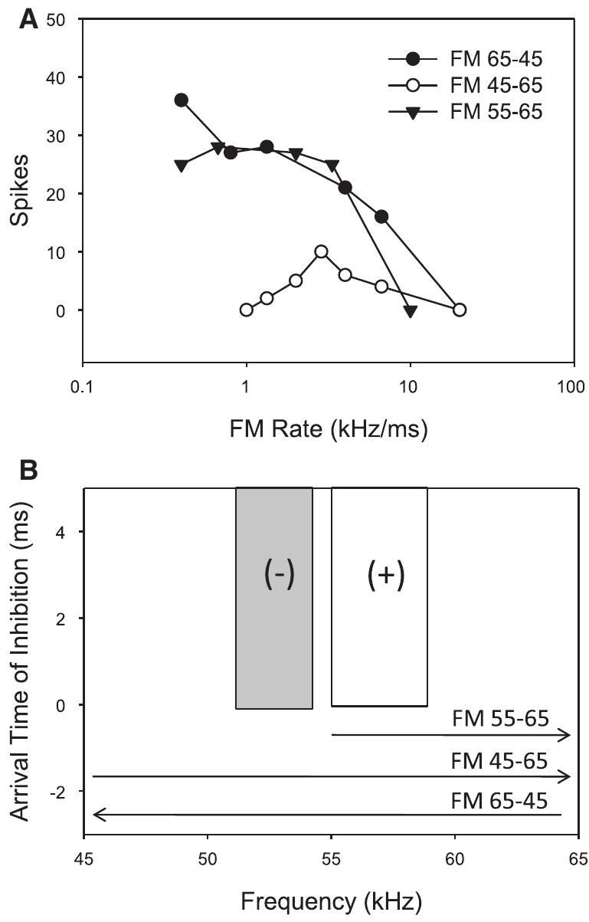
Removing low frequencies removes direction tuning
An upward sweep encounters low frequencies before reaching a neuron’s excitatory frequency band. If low-frequency inhibition acts early, it can prevent spikes when excitation arrives. A downward sweep reaches excitation before crossing that low-frequency inhibitory region.
Williams and Fuzessery tested this relationship by removing low frequencies from upward sweeps. A published neuron responded similarly to upward and downward sweeps when frequencies below 55 kHz were excluded from the upward stimulus. Those excluded frequencies overlapped its low-frequency inhibitory sideband.
Changing the stimulus spectrum thus removed a timing-dependent source of suppression without using a drug. The finding supports the sideband mechanism, but by itself cannot locate where the inhibitory selectivity is constructed. Local pharmacological tests are needed to assess the inferior-colliculus contribution.
Williams & Fuzessery (2011), Fig. 5(A–B). Removing the low-frequency inhibitory region permits upward-sweep responses.
Williams & Fuzessery (2011)
28
Notes:
• An upward sweep encounters low frequencies before reaching a neuron’s excitatory frequency band. If low-frequency inhibition acts early, it can prevent spikes when excitation arrives. A downward sweep reaches excitation before crossing that low-frequency inhibitory region.
• Williams and Fuzessery tested this relationship by removing low frequencies from upward sweeps. A published neuron responded similarly to upward and downward sweeps when frequencies below 55 kHz were excluded from the upward stimulus. Those excluded frequencies overlapped its low-frequency inhibitory sideband.
• Changing the stimulus spectrum thus removed a timing-dependent source of suppression without using a drug. The finding supports the sideband mechanism, but by itself cannot locate where the inhibitory selectivity is constructed. Local pharmacological tests are needed to assess the inferior-colliculus contribution.
• The manipulation preserves a sweep through the excitatory band while preventing stimulation of the lower inhibitory frequencies. The neuron can then respond to an upward sweep that was ineffective when the inhibitory frequencies were included.
References:
Williams AJ, Fuzessery ZM (2011). Differential roles of GABAergic and glycinergic input on FM selectivity in the inferior colliculus of the pallid bat. Journal of Neurophysiology 106(5):2523–2535. https://doi.org/10.1152/jn.00569.2011
Figure: Williams & Fuzessery (2011), Fig. 5(A–B). Removing the low-frequency inhibitory region permits upward-sweep responses.
Figure source: https://doi.org/10.1152/jn.00569.2011

Slide 29
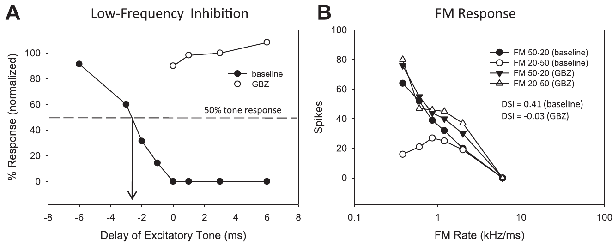
Low-frequency inhibition shapes direction tuning
Williams and Fuzessery measured low-frequency two-tone suppression before and during receptor blockade, then tested the same neuron’s responses to upward and downward sweeps. This linked a change in the inferred inhibitory mechanism to a change in FM selectivity.
When gabazine eliminated low-frequency inhibition in the published example, an inhibitory tone no longer suppressed excitation. The neuron simultaneously gained upward-sweep responses and lost its strong direction preference. Similar associations occurred across the relevant neurons tested with either blocker.
The paired measurements support LFI as a causal contributor to direction selectivity in these neurons. They are more specific than a general increase in firing after a drug. The experiment still does not reveal every cellular source of the inhibitory input or exclude other mechanisms in neurons outside the sampled subset.
Williams & Fuzessery (2011), Fig. 6(A–B). Gabazine removes low-frequency suppression and reduces direction selectivity.
Williams & Fuzessery (2011)
29
Notes:
• Williams and Fuzessery measured low-frequency two-tone suppression before and during receptor blockade, then tested the same neuron’s responses to upward and downward sweeps. This linked a change in the inferred inhibitory mechanism to a change in FM selectivity.
• When gabazine eliminated low-frequency inhibition in the published example, an inhibitory tone no longer suppressed excitation. The neuron simultaneously gained upward-sweep responses and lost its strong direction preference. Similar associations occurred across the relevant neurons tested with either blocker.
• The paired measurements support LFI as a causal contributor to direction selectivity in these neurons. They are more specific than a general increase in firing after a drug. The experiment still does not reveal every cellular source of the inhibitory input or exclude other mechanisms in neurons outside the sampled subset.
• The inhibitory test and the FM test probe different consequences of the same receptor manipulation. Their linked change supports the proposed mechanism without requiring a diagram of an unmeasured synaptic circuit.
References:
Williams AJ, Fuzessery ZM (2011). Differential roles of GABAergic and glycinergic input on FM selectivity in the inferior colliculus of the pallid bat. Journal of Neurophysiology 106(5):2523–2535. https://doi.org/10.1152/jn.00569.2011
Figure: Williams & Fuzessery (2011), Fig. 6(A–B). Gabazine removes low-frequency suppression and reduces direction selectivity.
Figure source: https://doi.org/10.1152/jn.00569.2011

Slide 30
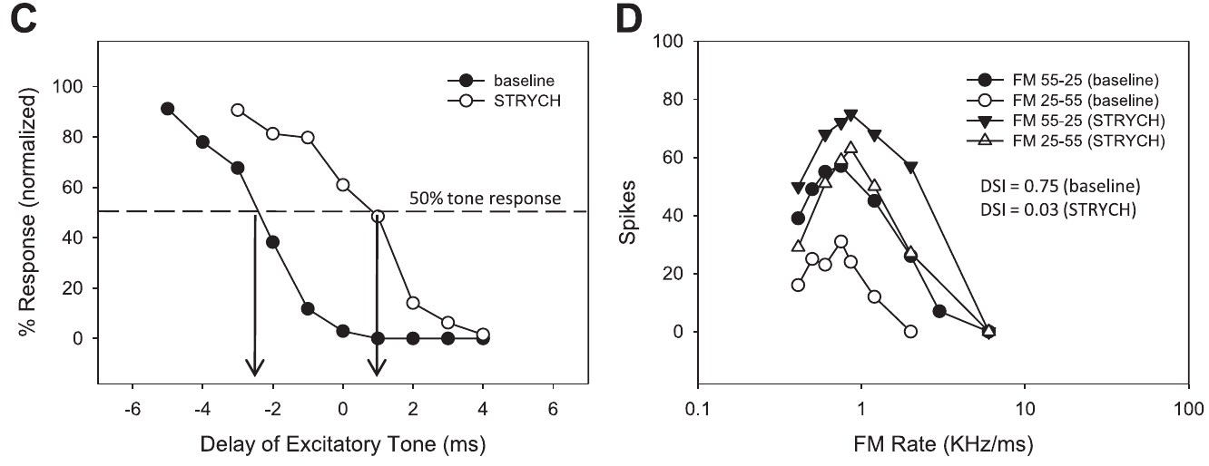
Delayed inhibition can lose its directional effect
Inhibition need not disappear completely for a neuron’s stimulus preference to change. The inhibitory effect can retain substantial strength but arrive too late to prevent excitation. Selectivity depends on timing as well as on the magnitude of suppression.
In one Williams and Fuzessery example, strychnine shifted the inferred LFI arrival from −2.5 to +1.0 ms relative to excitation, a 3.5-ms delay. The neuron’s strong downward preference was largely lost even though measurable inhibitory suppression remained.
An upward sweep could now evoke excitation before that inhibition became effective. The result supports temporal ordering of inhibitory and excitatory inputs as a determinant of direction selectivity. It does not mean that all residual inhibition is irrelevant or that receptor blockade uniformly changes input timing in every neuron.
Williams & Fuzessery (2011), Fig. 6(C–D). Delayed low-frequency inhibition accompanies reduced FM direction preference.
Williams & Fuzessery (2011)
30
Notes:
• Inhibition need not disappear completely for a neuron’s stimulus preference to change. The inhibitory effect can retain substantial strength but arrive too late to prevent excitation. Selectivity depends on timing as well as on the magnitude of suppression.
• In one Williams and Fuzessery example, strychnine shifted the inferred LFI arrival from −2.5 to +1.0 ms relative to excitation, a 3.5-ms delay. The neuron’s strong downward preference was largely lost even though measurable inhibitory suppression remained.
• An upward sweep could now evoke excitation before that inhibition became effective. The result supports temporal ordering of inhibitory and excitatory inputs as a determinant of direction selectivity. It does not mean that all residual inhibition is irrelevant or that receptor blockade uniformly changes input timing in every neuron.
• Negative and positive arrival values indicate relative order in the two-tone measurement. After the shift, excitation could occur before inhibition took effect, so a strong inhibitory input no longer necessarily prevented the initial response.
References:
Williams AJ, Fuzessery ZM (2011). Differential roles of GABAergic and glycinergic input on FM selectivity in the inferior colliculus of the pallid bat. Journal of Neurophysiology 106(5):2523–2535. https://doi.org/10.1152/jn.00569.2011
Figure: Williams & Fuzessery (2011), Fig. 6(C–D). Delayed low-frequency inhibition accompanies reduced FM direction preference.
Figure source: https://doi.org/10.1152/jn.00569.2011

Slide 31
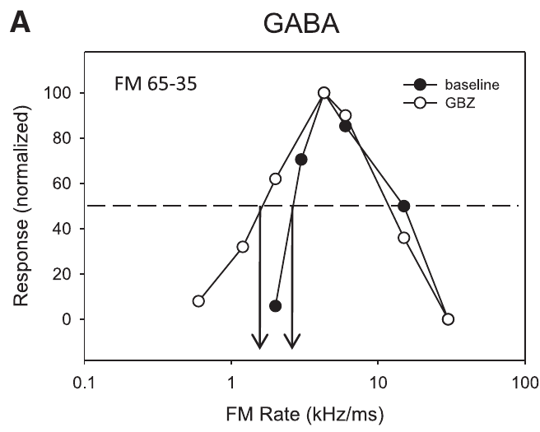
Sweep-rate tuning is more resistant to local blockade
Fast-pass rate selectivity means that a neuron responds better to rapid FM sweeps than to sufficiently slow sweeps. Williams and Fuzessery compared this feature with direction selectivity during local inhibitory receptor blockade in the pallid-bat inferior colliculus.
Gabazine did not eliminate fast-pass selectivity in the rate-selective neurons tested, even when firing changed. Strychnine could eliminate it in a minority of neurons, allowing responses to slow downward sweeps. Direction selectivity was generally more vulnerable to either blocker.
The different outcomes indicate that FM direction and rate are not interchangeable forms of tuning. Retention of rate selectivity is consistent with inheritance from lower auditory levels in many neurons. It does not prove that local inhibitory circuitry has no influence on their responses or on their exact rate threshold.
Williams & Fuzessery (2011), Fig. 7(A). Fast-pass sweep-rate preference remains during GABA_A receptor blockade.
Williams & Fuzessery (2011)
31
Notes:
• Fast-pass rate selectivity means that a neuron responds better to rapid FM sweeps than to sufficiently slow sweeps. Williams and Fuzessery compared this feature with direction selectivity during local inhibitory receptor blockade in the pallid-bat inferior colliculus.
• Gabazine did not eliminate fast-pass selectivity in the rate-selective neurons tested, even when firing changed. Strychnine could eliminate it in a minority of neurons, allowing responses to slow downward sweeps. Direction selectivity was generally more vulnerable to either blocker.
• The different outcomes indicate that FM direction and rate are not interchangeable forms of tuning. Retention of rate selectivity is consistent with inheritance from lower auditory levels in many neurons. It does not prove that local inhibitory circuitry has no influence on their responses or on their exact rate threshold.
• The gabazine example retains weak responses to the slowest sweeps. The presence of stronger responses elsewhere in the tuning curve does not by itself mean that the fast-pass preference has disappeared.
References:
Williams AJ, Fuzessery ZM (2011). Differential roles of GABAergic and glycinergic input on FM selectivity in the inferior colliculus of the pallid bat. Journal of Neurophysiology 106(5):2523–2535. https://doi.org/10.1152/jn.00569.2011
Figure: Williams & Fuzessery (2011), Fig. 7(A). Fast-pass sweep-rate preference remains during GABA_A receptor blockade.
Figure source: https://doi.org/10.1152/jn.00569.2011

Slide 32
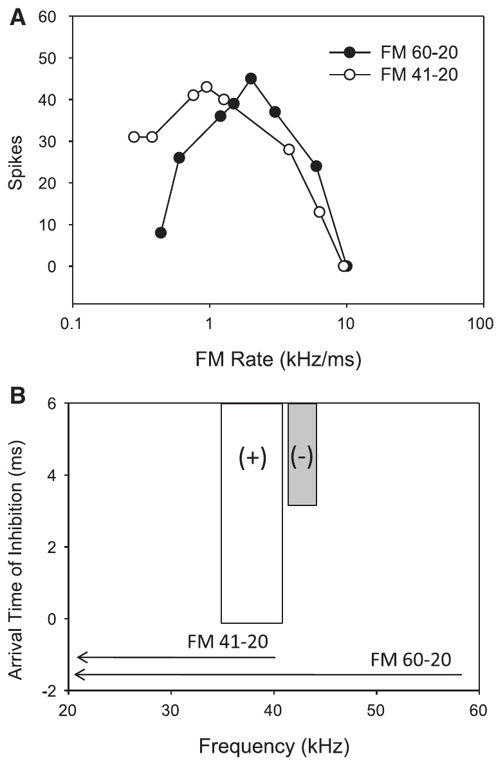
High-frequency inhibition can reject slow sweeps
A downward sweep activates high frequencies before reaching lower excitatory frequencies. Delayed HFI can arrive after excitation during a fast sweep, allowing spikes, but before excitation during a slow sweep, preventing the response. This ordering creates a fast-pass filter for sweep rate.
Williams and Fuzessery removed the high-frequency portion of a downward sweep to test this mechanism. A neuron selective for fast sweeps began responding to slow sweeps when frequencies above 41 kHz were excluded. Those frequencies had activated its inhibitory sideband.
The response depends on both the sweep’s spectral path and its duration. The experiment supports a role for HFI in rate selectivity rather than treating slow sweeps as inherently ineffective excitatory sounds. It does not identify the anatomical source of the inhibitory sideband.
Williams & Fuzessery (2011), Fig. 8(A–B). Removing high-frequency inhibitory input permits responses to slow downward sweeps.
Williams & Fuzessery (2011)
32
Notes:
• A downward sweep activates high frequencies before reaching lower excitatory frequencies. Delayed HFI can arrive after excitation during a fast sweep, allowing spikes, but before excitation during a slow sweep, preventing the response. This ordering creates a fast-pass filter for sweep rate.
• Williams and Fuzessery removed the high-frequency portion of a downward sweep to test this mechanism. A neuron selective for fast sweeps began responding to slow sweeps when frequencies above 41 kHz were excluded. Those frequencies had activated its inhibitory sideband.
• The response depends on both the sweep’s spectral path and its duration. The experiment supports a role for HFI in rate selectivity rather than treating slow sweeps as inherently ineffective excitatory sounds. It does not identify the anatomical source of the inhibitory sideband.
• With the high-frequency region omitted, the sweep still crosses frequencies capable of exciting the neuron. The new response to slow sweeps indicates that the removed high frequencies had suppressed those responses.
References:
Williams AJ, Fuzessery ZM (2011). Differential roles of GABAergic and glycinergic input on FM selectivity in the inferior colliculus of the pallid bat. Journal of Neurophysiology 106(5):2523–2535. https://doi.org/10.1152/jn.00569.2011
Figure: Williams & Fuzessery (2011), Fig. 8(A–B). Removing high-frequency inhibitory input permits responses to slow downward sweeps.
Figure source: https://doi.org/10.1152/jn.00569.2011

Slide 33
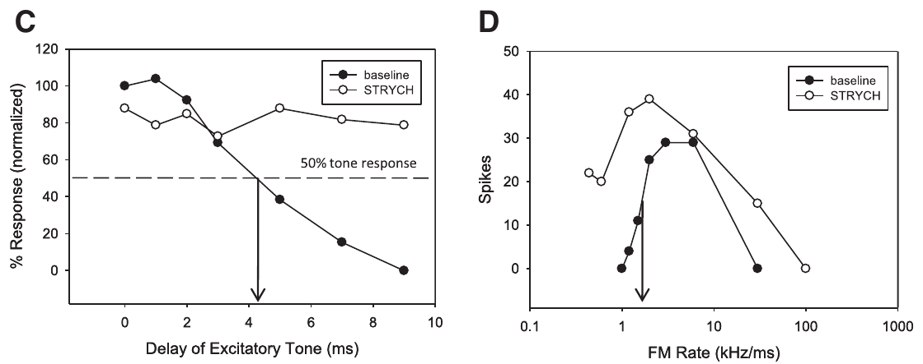
Glycine blockade can remove high-frequency suppression
Williams and Fuzessery paired measurements of high-frequency two-tone suppression with measurements of downward-sweep rate tuning. This tested whether the neurons losing fast-pass selectivity also lost the inhibitory sideband proposed to create it.
In a published strychnine example, HFI was eliminated and the neuron gained responses to slow sweeps. Gabazine examples retained both HFI and fast-pass selectivity. Local glycinergic input therefore supported this form of rate tuning in the affected neurons.
The finding is a selective contribution of a receptor pathway, not a universal assignment of every FM property to glycine. Many rate-selective neurons retained their preference after blockade, and the study’s inference concerns sideband-based selectivity. Other rate mechanisms and upstream contributions were not eliminated by this experiment.
Williams & Fuzessery (2011), Fig. 9(C–D). Strychnine removes high-frequency suppression and fast-pass rate selectivity.
Williams & Fuzessery (2011)
33
Notes:
• Williams and Fuzessery paired measurements of high-frequency two-tone suppression with measurements of downward-sweep rate tuning. This tested whether the neurons losing fast-pass selectivity also lost the inhibitory sideband proposed to create it.
• In a published strychnine example, HFI was eliminated and the neuron gained responses to slow sweeps. Gabazine examples retained both HFI and fast-pass selectivity. Local glycinergic input therefore supported this form of rate tuning in the affected neurons.
• The finding is a selective contribution of a receptor pathway, not a universal assignment of every FM property to glycine. Many rate-selective neurons retained their preference after blockade, and the study’s inference concerns sideband-based selectivity. Other rate mechanisms and upstream contributions were not eliminated by this experiment.
• The pharmacological result agrees with the earlier spectral-removal test. One manipulation prevents stimulation of the inhibitory frequencies; the other removes a local receptor contribution to their suppressive action.
References:
Williams AJ, Fuzessery ZM (2011). Differential roles of GABAergic and glycinergic input on FM selectivity in the inferior colliculus of the pallid bat. Journal of Neurophysiology 106(5):2523–2535. https://doi.org/10.1152/jn.00569.2011
Figure: Williams & Fuzessery (2011), Fig. 9(C–D). Strychnine removes high-frequency suppression and fast-pass rate selectivity.
Figure source: https://doi.org/10.1152/jn.00569.2011

Slide 34
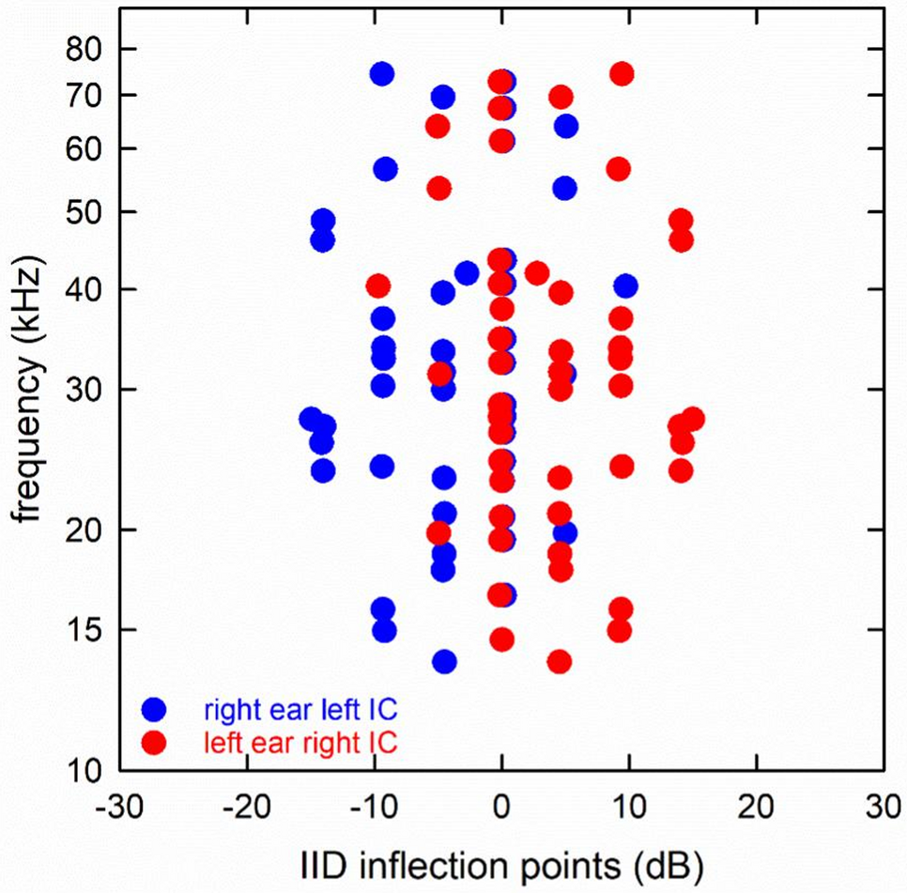
Local and inherited selectivity can coexist
The inferior colliculus receives inhibitory and excitatory inputs from several ascending pathways as well as local and commissural connections. The paper identifies GABAergic sources including the dorsal nucleus of the lateral lemniscus; lower brainstem regions can supply both GABAergic and glycinergic inputs.
Receptor blockade near a recorded neuron tests the contribution of inhibition acting at that site. A direction preference that disappears was created or refined locally. A rate preference that persists may already be present in incoming activity, although resistant local mechanisms cannot be excluded completely.
Williams and Fuzessery inferred substantial local construction of direction selectivity and greater inheritance of sideband-based rate selectivity. They did not directly map the full presynaptic circuit. The same response property can be inherited, transformed, or reconstructed at successive auditory levels.
Simmons & Simmons (2026), Fig. 4. Interaural-level inflection points of 56 big brown bat IC neurons by best frequency.
Williams & Fuzessery (2011); Simmons & Simmons (2026)
34
Notes:
• The inferior colliculus receives inhibitory and excitatory inputs from several ascending pathways as well as local and commissural connections. The paper identifies GABAergic sources including the dorsal nucleus of the lateral lemniscus; lower brainstem regions can supply both GABAergic and glycinergic inputs.
• Receptor blockade near a recorded neuron tests the contribution of inhibition acting at that site. A direction preference that disappears was created or refined locally. A rate preference that persists may already be present in incoming activity, although resistant local mechanisms cannot be excluded completely.
• Williams and Fuzessery inferred substantial local construction of direction selectivity and greater inheritance of sideband-based rate selectivity. They did not directly map the full presynaptic circuit. The same response property can be inherited, transformed, or reconstructed at successive auditory levels.
• Ascending inputs need not begin as neutral carriers of frequency. They can already be selective for sound patterns. Local integration may preserve their preference or modify it when selective and nonselective signals converge.
References:
Williams AJ, Fuzessery ZM (2011). Differential roles of GABAergic and glycinergic input on FM selectivity in the inferior colliculus of the pallid bat. Journal of Neurophysiology 106(5):2523–2535. https://doi.org/10.1152/jn.00569.2011
Simmons JA, Simmons AM (2026). Beamforming as a mechanism for azimuthal localization of targets by FM-echolocating big brown bats. Journal of Comparative Physiology A 212(5):901–911. https://doi.org/10.1007/s00359-026-01834-0
Figure: Simmons & Simmons (2026), Fig. 4. Interaural-level inflection points of 56 big brown bat IC neurons by best frequency.
Figure source: https://doi.org/10.1007/s00359-026-01834-0

Slide 35
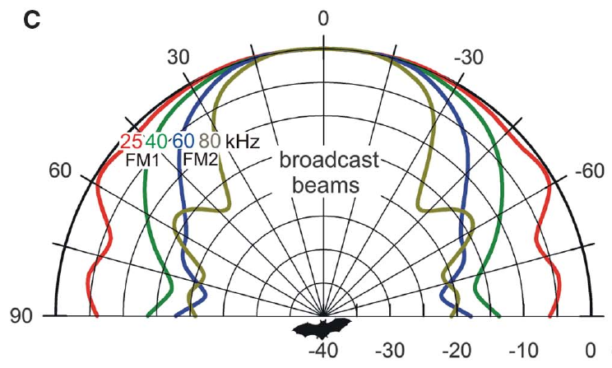
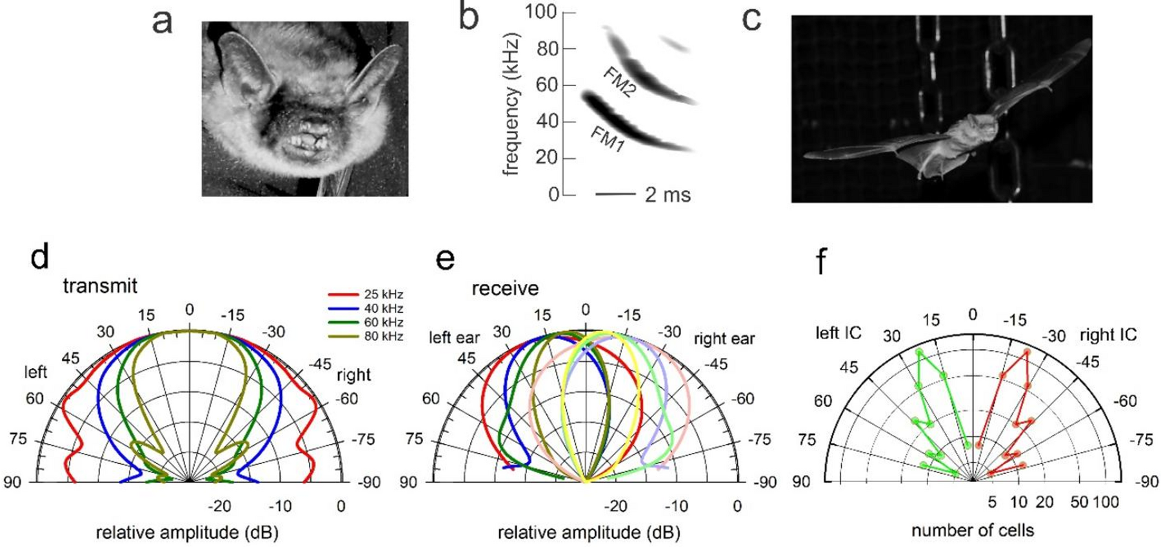
The two harmonics have different beam widths
The sonar beam is the directional distribution of a bat’s emitted sound. Its width depends on frequency. Bates and colleagues describe a horizontal beam spanning about 70° to each side at 25 kHz, compared with about 30° at 80 kHz.
A target near the beam axis receives both FM1 and FM2 strongly. Objects off to the side receive proportionally less high-frequency FM2 because its beam is narrower. The returning echo’s harmonic balance therefore contains information related to where the reflecting object was ensonified.
This acoustic relationship can help distinguish a forward target from lateral clutter, reflections from objects irrelevant to the current target. Beam width alone does not establish successful neural segregation; the behavioral experiments tested whether bats use the resulting harmonic differences to reduce interference.
Bates et al. (2011), Fig. 1(C). Published frequency-dependent horizontal beam patterns.
Simmons & Simmons (2026), Fig. 1. Big brown bat head, FM1/FM2 call, flight corridor, and transmit and receive beams.
Bates et al. (2011); Simmons & Simmons (2026)
35
Notes:
• The sonar beam is the directional distribution of a bat’s emitted sound. Its width depends on frequency. Bates and colleagues describe a horizontal beam spanning about 70° to each side at 25 kHz, compared with about 30° at 80 kHz.
• A target near the beam axis receives both FM1 and FM2 strongly. Objects off to the side receive proportionally less high-frequency FM2 because its beam is narrower. The returning echo’s harmonic balance therefore contains information related to where the reflecting object was ensonified.
• This acoustic relationship can help distinguish a forward target from lateral clutter, reflections from objects irrelevant to the current target. Beam width alone does not establish successful neural segregation; the behavioral experiments tested whether bats use the resulting harmonic differences to reduce interference.
• High frequencies are not simply absent from every lateral echo. Their relative strength declines with direction, and the experiment tested the perceptual consequence of this difference by manipulating harmonics electronically.
References:
Bates ME, Simmons JA, Zorikov TV (2011). Bats use echo harmonic structure to distinguish their targets from background clutter. Science 333(6042):627–630. https://doi.org/10.1126/science.1202065
Simmons JA, Simmons AM (2026). Beamforming as a mechanism for azimuthal localization of targets by FM-echolocating big brown bats. Journal of Comparative Physiology A 212(5):901–911. https://doi.org/10.1007/s00359-026-01834-0
Figure: Bates et al. (2011), Fig. 1(C). Published frequency-dependent horizontal beam patterns.
Figure source: https://doi.org/10.1126/science.1202065
Figure: Simmons & Simmons (2026), Fig. 1. Big brown bat head, FM1/FM2 call, flight corridor, and transmit and receive beams.
Figure source: https://doi.org/10.1007/s00359-026-01834-0

Slide 36
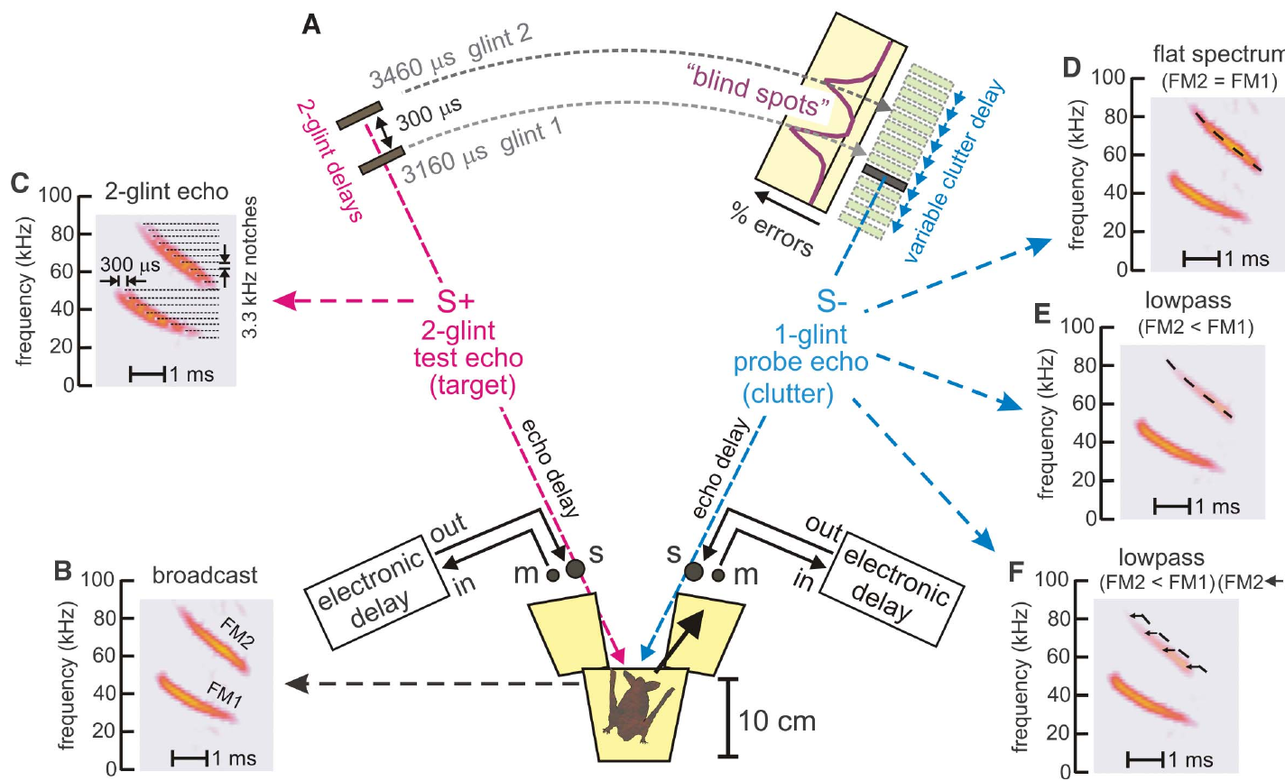
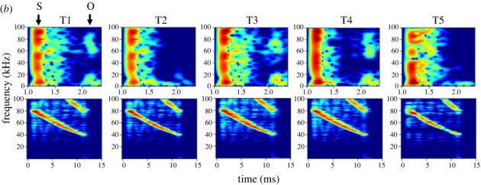
A two-glint echo provides a structured target
An acoustic glint is a reflection from one part of a target. Bates and colleagues used a rewarded virtual target containing two glints at delays of 3,160 and 3,460 μs. The 300-μs separation created a structured echo rather than one isolated reflection.
A bat on a Y-shaped platform emitted calls that microphones captured and returned through electronic delay channels. The unrewarded probe contained one glint and was presented from the opposite loudspeaker. Its delay was varied around the two rewarded glint delays.
The design measured how another echo interfered with perception of the target’s structure and timing. The electronic target provided controlled harmonic content and delay; it was not a natural insect recording. Its value was the ability to change one echo property while retaining the rest of the task.
Bates et al. (2011), Fig. 2(A–F). Two-choice apparatus and controlled target and probe echoes.
Teshima et al. (2024), Fig. 2b. Echo impulse responses and FM echoes from five targets; surface (S) and occlusion (O) parts.
Bates et al. (2011); Teshima et al. (2024)
36
Notes:
• An acoustic glint is a reflection from one part of a target. Bates and colleagues used a rewarded virtual target containing two glints at delays of 3,160 and 3,460 μs. The 300-μs separation created a structured echo rather than one isolated reflection.
• A bat on a Y-shaped platform emitted calls that microphones captured and returned through electronic delay channels. The unrewarded probe contained one glint and was presented from the opposite loudspeaker. Its delay was varied around the two rewarded glint delays.
• The design measured how another echo interfered with perception of the target’s structure and timing. The electronic target provided controlled harmonic content and delay; it was not a natural insect recording. Its value was the ability to change one echo property while retaining the rest of the task.
• The bat was rewarded for choosing the two-glint target. Moving the probe in delay tested when a separate reflection interfered with that choice, while electronic filters permitted independent manipulation of the two harmonics.
References:
Bates ME, Simmons JA, Zorikov TV (2011). Bats use echo harmonic structure to distinguish their targets from background clutter. Science 333(6042):627–630. https://doi.org/10.1126/science.1202065
Teshima Y, Mogi M, Nishida H, Tsuchiya T, Kobayasi KI, Hiryu S (2024). Discrimination of object information by bat echolocation deciphered from acoustic simulations. Royal Society Open Science 11(1):231415. https://doi.org/10.1098/rsos.231415
Figure: Bates et al. (2011), Fig. 2(A–F). Two-choice apparatus and controlled target and probe echoes.
Figure source: https://doi.org/10.1126/science.1202065
Figure: Teshima et al. (2024), Fig. 2b. Echo impulse responses and FM echoes from five targets; surface (S) and occlusion (O) parts.
Figure source: https://doi.org/10.1098/rsos.231415

Slide 37
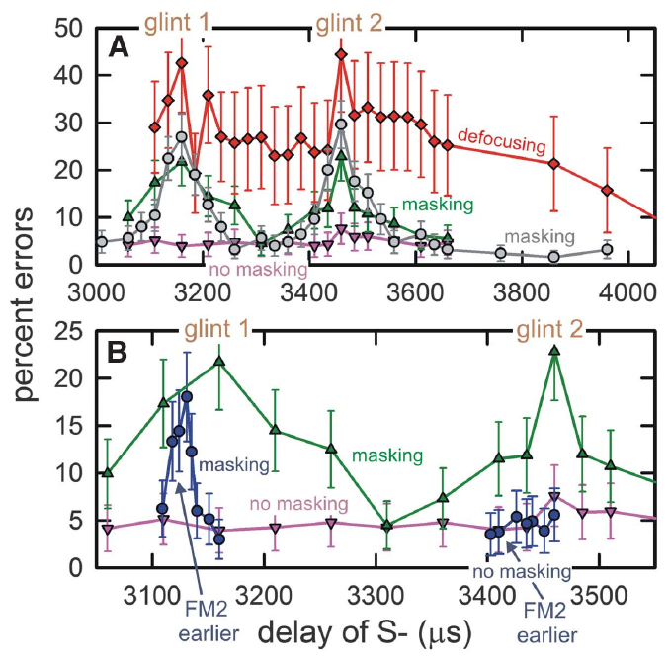
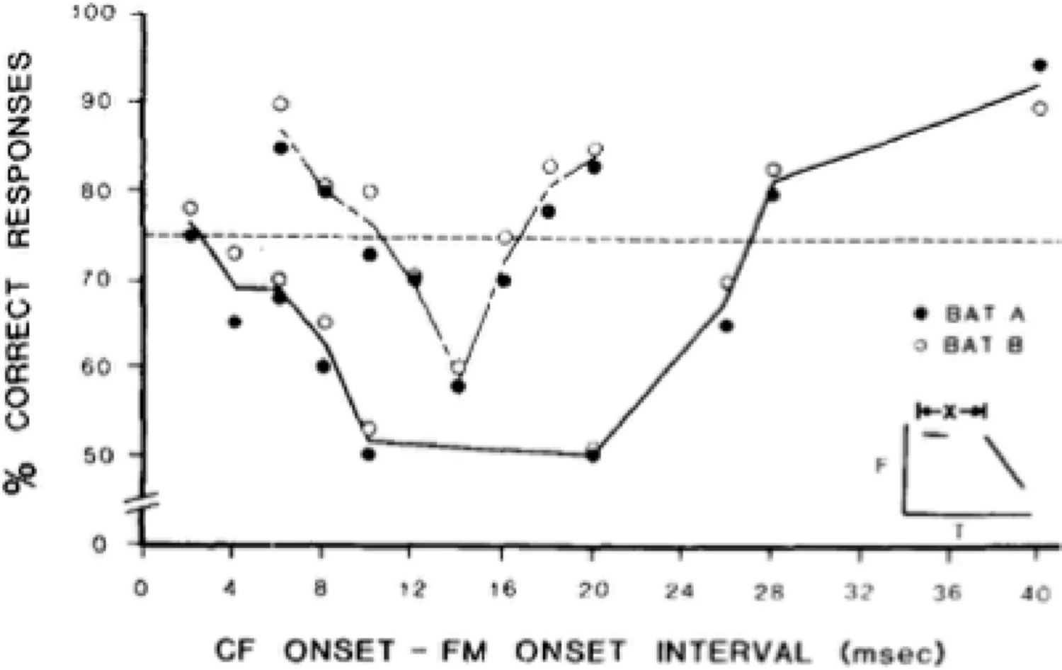
Similar echo delays can create masking blind spots
Masking is interference by one sound with perception of another. In the Bates experiment, a flat-spectrum probe echo produced a sharp increase in errors when its delay approached either glint of the rewarded target. Flat-spectrum here means relatively balanced FM1 and FM2 content.
The masking regions extended roughly 50 μs to either side of each target glint. A separate error peak occurred near 3,160 μs and near 3,460 μs. Baseline errors were low when the probe’s delay lay outside these regions.
Temporal proximity can therefore disrupt a target judgment even when echoes come from different directions. The operational “blind spot” is a delay region with impaired discrimination, not anatomical damage or complete inability to hear sound. The experiment measured the chosen target’s perceptual interference under controlled feedback conditions.
Bates et al. (2011), Fig. 3(A–B). Discrimination errors peak near the two target-glint delays.
Grinnell (2026), Fig. 5. Interference by artificial CF-FM echoes as a function of CF–FM onset interval.
Bates et al. (2011); Grinnell (2026)
37
Notes:
• Masking is interference by one sound with perception of another. In the Bates experiment, a flat-spectrum probe echo produced a sharp increase in errors when its delay approached either glint of the rewarded target. Flat-spectrum here means relatively balanced FM1 and FM2 content.
• The masking regions extended roughly 50 μs to either side of each target glint. A separate error peak occurred near 3,160 μs and near 3,460 μs. Baseline errors were low when the probe’s delay lay outside these regions.
• Temporal proximity can therefore disrupt a target judgment even when echoes come from different directions. The operational “blind spot” is a delay region with impaired discrimination, not anatomical damage or complete inability to hear sound. The experiment measured the chosen target’s perceptual interference under controlled feedback conditions.
• Masking was measured through incorrect choices, not disappearance of an auditory-nerve response. The bat could still receive acoustic input while being less able to distinguish the rewarded target from the probe.
References:
Bates ME, Simmons JA, Zorikov TV (2011). Bats use echo harmonic structure to distinguish their targets from background clutter. Science 333(6042):627–630. https://doi.org/10.1126/science.1202065
Grinnell AD (2026). Reflections on the neural processing of echoes for distance information in echolocating bats. Journal of Comparative Physiology A 212(5):913–926. https://doi.org/10.1007/s00359-026-01804-6
Figure: Bates et al. (2011), Fig. 3(A–B). Discrimination errors peak near the two target-glint delays.
Figure source: https://doi.org/10.1126/science.1202065
Figure: Grinnell (2026), Fig. 5. Interference by artificial CF-FM echoes as a function of CF–FM onset interval.
Figure source: https://doi.org/10.1007/s00359-026-01804-6

Slide 38
Weakening FM2 can prevent a probe from masking
Low-pass filtering weakens higher frequencies more than lower frequencies. Bates and colleagues applied mild low-pass filtering to the probe echo, reducing FM2 relative to FM1 by an average of about 1.5 dB. This approximated harmonic imbalance in nearby lateral clutter.
The filtered probe no longer produced the masking peaks caused by the balanced probe at similar delays. The experiment retained the rewarded target’s structure and changed the interfering echo, so the improvement was not caused by making the target itself easier through a new target delay.
A small harmonic imbalance could therefore strongly alter interference in the task. The result supports use of echo spectral structure for clutter rejection. It does not imply that every natural clutter echo has the same spectrum or that filtering always leaves target information intact.
Bates et al. (2011), Fig. 3(A–B). Low-pass probe echoes reduce masking; timing compensation can restore it.
Bates et al. (2011)
38
Notes:
• Low-pass filtering weakens higher frequencies more than lower frequencies. Bates and colleagues applied mild low-pass filtering to the probe echo, reducing FM2 relative to FM1 by an average of about 1.5 dB. This approximated harmonic imbalance in nearby lateral clutter.
• The filtered probe no longer produced the masking peaks caused by the balanced probe at similar delays. The experiment retained the rewarded target’s structure and changed the interfering echo, so the improvement was not caused by making the target itself easier through a new target delay.
• A small harmonic imbalance could therefore strongly alter interference in the task. The result supports use of echo spectral structure for clutter rejection. It does not imply that every natural clutter echo has the same spectrum or that filtering always leaves target information intact.
• The probe still existed acoustically after filtering. The important change was its diminished ability to interfere with the target choice, rather than simple removal of the entire sound from the stimulus sequence.
References:
Bates ME, Simmons JA, Zorikov TV (2011). Bats use echo harmonic structure to distinguish their targets from background clutter. Science 333(6042):627–630. https://doi.org/10.1126/science.1202065
Figure: Bates et al. (2011), Fig. 3(A–B). Low-pass probe echoes reduce masking; timing compensation can restore it.
Figure source: https://doi.org/10.1126/science.1202065

Slide 39


Harmonic timing links acuity and clutter rejection
Bates and colleagues proposed that weaker FM2 evokes later neural responses through amplitude–latency trading. Responses to the two harmonics then become misaligned. They interpreted this mismatch as defocusing, loss of a sharply specified echo-delay percept.
For the roughly 1.5-dB FM2 reduction, the proposed relative latency shift was about 24 μs. Advancing FM2 electronically by approximately 25–45 μs restored masking of the first target glint, consistent with compensation for that level-dependent timing shift.
The manipulation links harmonic timing to the trade-off between precise delay perception and resistance to clutter. Neural responses were inferred from prior timing measurements rather than recorded in this behavioral experiment. Recovery differed between the two target glints, so the result is not a uniform restoration of every part of the target image.
Bates et al. (2011), Fig. 3(C). Harmonic timing differences relate delay defocusing to masking recovery.
Ming et al. (2020), Fig. 1C. Delay jitter acuity after high-pass or low-pass removal of FM1 or FM2 frequencies.
Bates et al. (2011); Ming et al. (2020)
39
Notes:
• Bates and colleagues proposed that weaker FM2 evokes later neural responses through amplitude–latency trading. Responses to the two harmonics then become misaligned. They interpreted this mismatch as defocusing, loss of a sharply specified echo-delay percept.
• For the roughly 1.5-dB FM2 reduction, the proposed relative latency shift was about 24 μs. Advancing FM2 electronically by approximately 25–45 μs restored masking of the first target glint, consistent with compensation for that level-dependent timing shift.
• The manipulation links harmonic timing to the trade-off between precise delay perception and resistance to clutter. Neural responses were inferred from prior timing measurements rather than recorded in this behavioral experiment. Recovery differed between the two target glints, so the result is not a uniform restoration of every part of the target image.
• The experiment altered acoustic timing to test a proposed neural-timing consequence of harmonic attenuation. Agreement with that prediction supports the mechanism while preserving the distinction between measured choices and inferred response alignment.
References:
Bates ME, Simmons JA, Zorikov TV (2011). Bats use echo harmonic structure to distinguish their targets from background clutter. Science 333(6042):627–630. https://doi.org/10.1126/science.1202065
Ming C, Bates ME, Simmons JA (2020). How frequency hopping suppresses pulse-echo ambiguity in bat biosonar. Proceedings of the National Academy of Sciences 117(29):17288–17295. https://doi.org/10.1073/pnas.2001105117
Figure: Bates et al. (2011), Fig. 3(C). Harmonic timing differences relate delay defocusing to masking recovery.
Figure source: https://doi.org/10.1126/science.1202065
Figure: Ming et al. (2020), Fig. 1C. Delay jitter acuity after high-pass or low-pass removal of FM1 or FM2 frequencies.
Figure source: https://doi.org/10.1073/pnas.2001105117

Slide 40

Rapid calling can mix echoes from different broadcasts
The interpulse interval, or IPI, is the time between successive broadcasts. The echo epoch is the period during which reflections from one broadcast return from objects distributed across a scene. A long-range reflector may return sound after a nearer one.
Ming and colleagues discuss cases in which the IPI becomes shorter than the echo epoch. Their published examples compare a 32-ms IPI with shorter echo epochs and a 22-ms IPI with overlapping epochs. Echoes from one broadcast can arrive after the next broadcast has occurred.
This creates pulse–echo ambiguity, uncertainty about which broadcast generated a reflection. Measuring delay from the wrong broadcast assigns an incorrect range. Rapid updates needed for nearby obstacles can therefore conflict with waiting for all distant echoes to finish returning.
Ming et al. (2020), Fig. 2(A–B). Separate and overlapping echo epochs at different interpulse intervals.
Ming et al. (2020)
40
Notes:
• The interpulse interval, or IPI, is the time between successive broadcasts. The echo epoch is the period during which reflections from one broadcast return from objects distributed across a scene. A long-range reflector may return sound after a nearer one.
• Ming and colleagues discuss cases in which the IPI becomes shorter than the echo epoch. Their published examples compare a 32-ms IPI with shorter echo epochs and a 22-ms IPI with overlapping epochs. Echoes from one broadcast can arrive after the next broadcast has occurred.
• This creates pulse–echo ambiguity, uncertainty about which broadcast generated a reflection. Measuring delay from the wrong broadcast assigns an incorrect range. Rapid updates needed for nearby obstacles can therefore conflict with waiting for all distant echoes to finish returning.
• An echo’s arrival time alone does not label its originating call if echo streams overlap. The examples in this paper were published to describe the ambiguity created by rapid calling in extended scenes.
References:
Ming C, Bates ME, Simmons JA (2020). How frequency hopping suppresses pulse-echo ambiguity in bat biosonar. Proceedings of the National Academy of Sciences 117(29):17288–17295. https://doi.org/10.1073/pnas.2001105117
Figure: Ming et al. (2020), Fig. 2(A–B). Separate and overlapping echo epochs at different interpulse intervals.
Figure source: https://doi.org/10.1073/pnas.2001105117

Slide 41

Lowest FM1 frequencies anchor the tested delay percept
Ming and colleagues used a two-choice virtual-echo task to test which frequency regions supported target discrimination. They progressively removed either high or low frequencies from the rewarded two-glint echo while keeping the unrewarded comparison echo broadband.
Low-pass filtering left discrimination effective when only approximately 25–30 kHz remained. High-pass filtering that removed this low-frequency end disrupted performance even while most higher FM1 frequencies and FM2 remained. The two filtering directions therefore had very different effects.
The authors proposed that frequency hopping, shifts of several kilohertz between broadcasts, could use this low-frequency anchor to segregate overlapping echo streams. The filtering result is measured behavior; the full pulse-assignment mechanism and its SCAT receiver implementation remain proposed or modeled explanations rather than direct neural recordings.
Ming et al. (2020), Fig. 3(B). Opposite effects of low-pass and high-pass filtering on echo discrimination.
Ming et al. (2020)
41
Notes:
• Ming and colleagues used a two-choice virtual-echo task to test which frequency regions supported target discrimination. They progressively removed either high or low frequencies from the rewarded two-glint echo while keeping the unrewarded comparison echo broadband.
• Low-pass filtering left discrimination effective when only approximately 25–30 kHz remained. High-pass filtering that removed this low-frequency end disrupted performance even while most higher FM1 frequencies and FM2 remained. The two filtering directions therefore had very different effects.
• The authors proposed that frequency hopping, shifts of several kilohertz between broadcasts, could use this low-frequency anchor to segregate overlapping echo streams. The filtering result is measured behavior; the full pulse-assignment mechanism and its SCAT receiver implementation remain proposed or modeled explanations rather than direct neural recordings.
• The key experimental asymmetry is between retaining the bottom of FM1 and removing it. The frequency-hopping account applies this result to overlapping broadcasts, but the filtering test itself does not record an identified neuronal pulse-assignment circuit.
References:
Ming C, Bates ME, Simmons JA (2020). How frequency hopping suppresses pulse-echo ambiguity in bat biosonar. Proceedings of the National Academy of Sciences 117(29):17288–17295. https://doi.org/10.1073/pnas.2001105117
Figure: Ming et al. (2020), Fig. 3(B). Opposite effects of low-pass and high-pass filtering on echo discrimination.
Figure source: https://doi.org/10.1073/pnas.2001105117

Slide 42


Nearby vegetation reduces prey-capture success
Moss and colleagues studied freely flying big brown bats capturing tethered insects near a plant. Synchronized ultrasound recordings and high-speed video linked emitted sounds to reconstructed three-dimensional flight paths. The open-room condition provided a comparison without the plant’s nearby echo clutter.
With the insect 10 cm from vegetation, bats hit or captured it in about 40% of trials and made no attempt in nearly half. Hits or captures increased to almost 80% at 20 cm and about 90% at 40 cm. Open-room performance was nearly complete.
Clutter therefore affected both willingness to attempt interception and success after approach. The combined hit/capture measure is broader than successful consumption. The experiment reveals difficulty under controlled vegetation spacing rather than a universal minimum separation for catching prey in natural habitats.
Moss et al. (2006), Fig. 2. Interception outcomes at three plant–target separations and in an open room.
Ma et al. (2025), Fig. 1A–F. Hipposideros pratti foraging: call rate and terminal buzz for different prey states.
Moss et al. (2006); Ma et al. (2025)
42
Notes:
• Moss and colleagues studied freely flying big brown bats capturing tethered insects near a plant. Synchronized ultrasound recordings and high-speed video linked emitted sounds to reconstructed three-dimensional flight paths. The open-room condition provided a comparison without the plant’s nearby echo clutter.
• With the insect 10 cm from vegetation, bats hit or captured it in about 40% of trials and made no attempt in nearly half. Hits or captures increased to almost 80% at 20 cm and about 90% at 40 cm. Open-room performance was nearly complete.
• Clutter therefore affected both willingness to attempt interception and success after approach. The combined hit/capture measure is broader than successful consumption. The experiment reveals difficulty under controlled vegetation spacing rather than a universal minimum separation for catching prey in natural habitats.
• The behavioral categories distinguish failure to attempt from an attempted approach that missed or was aborted. A decline in the combined success measure cannot automatically be assigned to failure of target detection alone.
References:
Moss CF, Bohn K, Gilkenson H, Surlykke A (2006). Active listening for spatial orientation in a complex auditory scene. PLoS Biology 4(4):e79. https://doi.org/10.1371/journal.pbio.0040079
Ma N, Xia H, Zheng H, Luo J (2025). Prey evasiveness and masking noise jointly promote the ultrahigh call rate in echolocating bats. BMC Biology 23:323. https://doi.org/10.1186/s12915-025-02435-0
Figure: Moss et al. (2006), Fig. 2. Interception outcomes at three plant–target separations and in an open room.
Figure source: https://doi.org/10.1371/journal.pbio.0040079
Figure: Ma et al. (2025), Fig. 1A–F. Hipposideros pratti foraging: call rate and terminal buzz for different prey states.
Figure source: https://doi.org/10.1186/s12915-025-02435-0

Slide 43


Flight paths change target–clutter separation
Bats in the Moss experiment often flew alongside the vegetation and insect before turning toward the target. The approach was not simply a straight line through the plant’s strongest echo direction. Flight geometry altered the angular relationship between prey and background.
As the target was placed closer to vegetation, the final direct approach became shorter and the late turn more abrupt. Three-dimensional trajectories and emitted pulse intervals were measured together. Strong changes in turning occurred mainly during the final 50–100 ms before contact.
The authors interpreted these trajectories as reducing interference by ensonifying prey off axis from vegetation during part of the approach. The paths are measured behavior, whereas that masking-reduction function is an interpretation supported by geometry. It was not tested by recording the bat’s full internal spatial representation.
Moss et al. (2006), Fig. 4. Measured flight paths and pulse intervals for clutter and open-room trials.
Simmons & Simmons (2026), Fig. 2a. Acoustic-camera view of echoes from a corridor of hanging chains.
Moss et al. (2006); Simmons & Simmons (2026)
43
Notes:
• Bats in the Moss experiment often flew alongside the vegetation and insect before turning toward the target. The approach was not simply a straight line through the plant’s strongest echo direction. Flight geometry altered the angular relationship between prey and background.
• As the target was placed closer to vegetation, the final direct approach became shorter and the late turn more abrupt. Three-dimensional trajectories and emitted pulse intervals were measured together. Strong changes in turning occurred mainly during the final 50–100 ms before contact.
• The authors interpreted these trajectories as reducing interference by ensonifying prey off axis from vegetation during part of the approach. The paths are measured behavior, whereas that masking-reduction function is an interpretation supported by geometry. It was not tested by recording the bat’s full internal spatial representation.
• Moving changes which objects lie in the emitted beam and the relative timing of their echoes. The animal can therefore alter the acoustic scene through its trajectory as well as through the structure of individual calls.
References:
Moss CF, Bohn K, Gilkenson H, Surlykke A (2006). Active listening for spatial orientation in a complex auditory scene. PLoS Biology 4(4):e79. https://doi.org/10.1371/journal.pbio.0040079
Simmons JA, Simmons AM (2026). Beamforming as a mechanism for azimuthal localization of targets by FM-echolocating big brown bats. Journal of Comparative Physiology A 212(5):901–911. https://doi.org/10.1007/s00359-026-01834-0
Figure: Moss et al. (2006), Fig. 4. Measured flight paths and pulse intervals for clutter and open-room trials.
Figure source: https://doi.org/10.1371/journal.pbio.0040079
Figure: Simmons & Simmons (2026), Fig. 2a. Acoustic-camera view of echoes from a corridor of hanging chains.
Figure source: https://doi.org/10.1007/s00359-026-01834-0

Slide 44


Sonar strobe groups control repeated scene sampling
Sonar strobe groups are clusters of calls separated from neighboring calls or groups by longer intervals. Moss and colleagues identified groups with stable internal intervals when they contained three or more sounds. This temporal organization occurred during approach before the terminal capture phase.
Within groups, pulse intervals shortened as the bat approached its target. Calls in the clutter conditions tended to be grouped at shorter intervals than calls in the open room. The group pattern added structure beyond an overall increase in call rate.
The authors proposed that repeated sampling at stable intervals could sharpen the spatial representation of the scene. The study measured vocal timing and behavior, not the proposed improvement in a neuronal population code. Grouping is therefore an established motor pattern with a hypothesized perceptual function.
Moss et al. (2006), Fig. 10(A,C). Strobing occurrence and within-group pulse intervals during approach.
Cadigan et al. (2026), Fig. 3. Call intervals and sonar sound groups for predictable and unpredictable target motion.
Moss et al. (2006); Cadigan et al. (2026)
44
Notes:
• Sonar strobe groups are clusters of calls separated from neighboring calls or groups by longer intervals. Moss and colleagues identified groups with stable internal intervals when they contained three or more sounds. This temporal organization occurred during approach before the terminal capture phase.
• Within groups, pulse intervals shortened as the bat approached its target. Calls in the clutter conditions tended to be grouped at shorter intervals than calls in the open room. The group pattern added structure beyond an overall increase in call rate.
• The authors proposed that repeated sampling at stable intervals could sharpen the spatial representation of the scene. The study measured vocal timing and behavior, not the proposed improvement in a neuronal population code. Grouping is therefore an established motor pattern with a hypothesized perceptual function.
• A group is defined by its relationship to the neighboring intervals, rather than simply by a high average call rate. Stable timing within groups can coexist with changes in group spacing as the bat approaches the insect.
References:
Moss CF, Bohn K, Gilkenson H, Surlykke A (2006). Active listening for spatial orientation in a complex auditory scene. PLoS Biology 4(4):e79. https://doi.org/10.1371/journal.pbio.0040079
Cadigan SC, Smith NA, Jones TK, Wohlgemuth MJ (2026). Unpredictable prey motion shapes behavior across time scales. Journal of Experimental Biology 229(15):jeb250896. https://doi.org/10.1242/jeb.250896
Figure: Moss et al. (2006), Fig. 10(A,C). Strobing occurrence and within-group pulse intervals during approach.
Figure source: https://doi.org/10.1371/journal.pbio.0040079
Figure: Cadigan et al. (2026), Fig. 3. Call intervals and sonar sound groups for predictable and unpredictable target motion.
Figure source: https://doi.org/10.1242/jeb.250896

Slide 45


The terminal buzz shortens near vegetation
The terminal buzz is the rapid-call sequence immediately before prey interception. Moss and colleagues defined buzz-II calls by pulse intervals of 10 ms or less and compared its duration across plant–target separations and the open-room condition.
Mean buzz-II duration declined from over 300 ms in the open room to about 200 ms at 40 cm from vegetation and about 100 ms at 10 cm. Prey capture was still sometimes successful with the shorter buzz, including at the closest tested separation.
The authors proposed that extended clutter echoes reduce the usefulness of prolonged rapid calling. The observed adjustment connects vocal timing to scene structure, but it does not directly establish the neural masking mechanism. Successful interception can involve coordinated changes in call groups, final approach geometry, and buzz duration.
Moss et al. (2006), Fig. 8. Buzz-II duration varies with target–vegetation separation.
Ma et al. (2025), Fig. 2B–C. Pulse intervals and spectrograms in silence and noise; buzz percentage by noise level.
Moss et al. (2006); Ma et al. (2025)
45
Notes:
• The terminal buzz is the rapid-call sequence immediately before prey interception. Moss and colleagues defined buzz-II calls by pulse intervals of 10 ms or less and compared its duration across plant–target separations and the open-room condition.
• Mean buzz-II duration declined from over 300 ms in the open room to about 200 ms at 40 cm from vegetation and about 100 ms at 10 cm. Prey capture was still sometimes successful with the shorter buzz, including at the closest tested separation.
• The authors proposed that extended clutter echoes reduce the usefulness of prolonged rapid calling. The observed adjustment connects vocal timing to scene structure, but it does not directly establish the neural masking mechanism. Successful interception can involve coordinated changes in call groups, final approach geometry, and buzz duration.
• A shorter terminal buzz is not simply proof that the bat has stopped sampling. The animal continues vocalizing and has already adjusted its approach and earlier call-group pattern, so several measured behaviors contribute to the final interception.
References:
Moss CF, Bohn K, Gilkenson H, Surlykke A (2006). Active listening for spatial orientation in a complex auditory scene. PLoS Biology 4(4):e79. https://doi.org/10.1371/journal.pbio.0040079
Ma N, Xia H, Zheng H, Luo J (2025). Prey evasiveness and masking noise jointly promote the ultrahigh call rate in echolocating bats. BMC Biology 23:323. https://doi.org/10.1186/s12915-025-02435-0
Figure: Moss et al. (2006), Fig. 8. Buzz-II duration varies with target–vegetation separation.
Figure source: https://doi.org/10.1371/journal.pbio.0040079
Figure: Ma et al. (2025), Fig. 2B–C. Pulse intervals and spectrograms in silence and noise; buzz percentage by noise level.
Figure source: https://doi.org/10.1186/s12915-025-02435-0

Slide 46
Key takeaways
Echo delay carries target range. Controlled electronic-delay experiments support relative-range judgments without changing the reflector’s physical distance.
Timing precision and latency differ. Population responses can arrive after milliseconds while repeating within tens of microseconds; weaker sounds can shift their latency.
Inhibition selects FM features. Early low-frequency inhibition shapes direction preference; delayed high-frequency inhibition can reject slow downward sweeps.
Harmonic structure affects clutter interference. Weakening FM2 can reduce masking, and compensating harmonic timing can restore part of that interference.
Call assignment is part of ranging. Overlapping echo epochs create pulse–echo ambiguity; lowest FM1 frequencies anchor the tested delay percept.
Active sensing changes the scene. Bats adjust flight paths, call groups, and terminal-buzz duration near vegetation; proposed neural benefits remain distinct from measured behavior.
Simmons (1973); Bates et al. (2011); Williams & Fuzessery (2011); Simmons et al. (2024); Moss et al. (2006); Ming et al. (2020)
46
Notes:
Simmons JA (1973). The resolution of target range by echolocating bats. Journal of the Acoustical Society of America 54(1):157–173. https://doi.org/10.1121/1.1913559
Bates ME, Simmons JA, Zorikov TV (2011). Bats use echo harmonic structure to distinguish their targets from background clutter. Science 333(6042):627–630. https://doi.org/10.1126/science.1202065
Williams AJ, Fuzessery ZM (2011). Differential roles of GABAergic and glycinergic input on FM selectivity in the inferior colliculus of the pallid bat. Journal of Neurophysiology 106(5):2523–2535. https://doi.org/10.1152/jn.00569.2011
Simmons AM, Warnecke M, Simmons JA (2024). Microseconds-level coding of echo delay in the auditory brainstem of an FM-echolocating bat. Journal of Neurophysiology 132(6):2012–2022. https://doi.org/10.1152/jn.00305.2024
Moss CF, Bohn K, Gilkenson H, Surlykke A (2006). Active listening for spatial orientation in a complex auditory scene. PLoS Biology 4(4):e79. https://doi.org/10.1371/journal.pbio.0040079
Ming C, Bates ME, Simmons JA (2020). How frequency hopping suppresses pulse-echo ambiguity in bat biosonar. Proceedings of the National Academy of Sciences 117(29):17288–17295. https://doi.org/10.1073/pnas.2001105117

