Slide 1
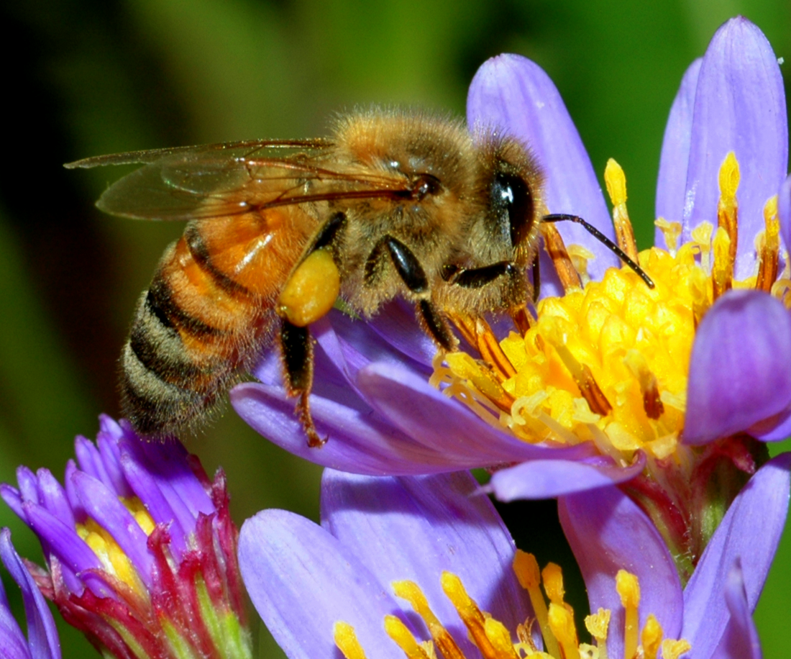
NEUR 411 · NEUROETHOLOGY · FALL 2026
Lecture 29
Navigation II: honeybee waggle dance and sun-compass navigation (von Frisch)
Monday, November 2, 2026
Photo: Honeybee (Apis mellifera), the classic species for waggle-dance and sun-compass navigation studies.
Jordan Lopez, Ph.D.
Professor of Neurobiology & Biomedical Engineering
Notes:
• Navigation II: honeybee waggle dance and sun-compass navigation (von Frisch)
• Honeybee foragers communicate a resource vector on the comb. The study animal is photographed within Dong et al. (2023), Figure 1A; the complete published panel retains its labels and dance-path annotation.
• Direction, visually calibrated distance, time compensation and terminal search are experimentally separable components of recruitment.
Figure: Dong et al. (2023), Fig. 1A. Waggle-run angle, return loops and following bees.
Figure source: https://doi.org/10.1126/science.ade1702
References:
Dong S, Lin T, Nieh JC, Tan K (2023). Social signal learning of the waggle dance in honey bees. Science 379(6636): 1015-1018. https://doi.org/10.1126/science.ade1702
Riley JR, Greggers U, Smith AD, Reynolds DR, Menzel R (2005). The flight paths of honeybees recruited by the waggle dance. Nature 435(7039): 205-207. https://doi.org/10.1038/nature03526

Slide 2
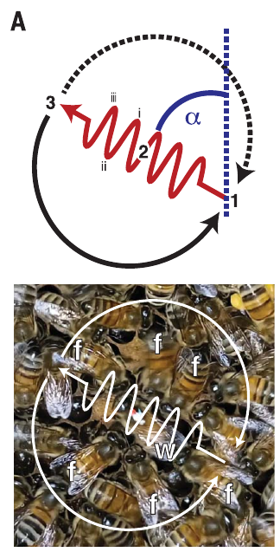
A waggle run encodes a resource vector
Foragers of Apis mellifera communicate a resource location through the waggle dance, repeated movements on the comb that contain a straight abdominal-wagging run and alternating return loops. A vector specifies a direction and a distance from an origin; here the origin is the hive.
Dong and colleagues filmed individually marked bees visiting a feeder 150 m away. The angle of the waggle run on a vertical comb encoded the food direction relative to the sun, while its duration encoded distance. Attending bees followed the dancer at close range.
The signal concerns a location outside the hive, rather than merely the dancer’s immediate position. Video measurements establish its spatial and temporal structure; successful communication additionally requires that followers obtain the signal and subsequently choose an appropriate flight. These are distinct experimental questions.
Dong et al. (2023), Fig. 1A. Waggle-run angle, return loops and following bees.
Dong et al. (2023)
02
Notes:
• Foragers of Apis mellifera communicate a resource location through the waggle dance, repeated movements on the comb that contain a straight abdominal-wagging run and alternating return loops. A vector specifies a direction and a distance from an origin; here the origin is the hive.
– The return loops bring the dancer back to the start of another waggle run. The loop itself is not a second advertised destination.
• Dong and colleagues filmed individually marked bees visiting a feeder 150 m away. The angle of the waggle run on a vertical comb encoded the food direction relative to the sun, while its duration encoded distance. Attending bees followed the dancer at close range.
• The signal concerns a location outside the hive, rather than merely the dancer’s immediate position. Video measurements establish its spatial and temporal structure; successful communication additionally requires that followers obtain the signal and subsequently choose an appropriate flight. These are distinct experimental questions.
References:
Dong S, Lin T, Nieh JC, Tan K (2023). Social signal learning of the waggle dance in honey bees. Science 379(6636): 1015-1018. https://doi.org/10.1126/science.ade1702
Figure: Dong et al. (2023), Fig. 1A. Waggle-run angle, return loops and following bees.
Figure source: https://doi.org/10.1126/science.ade1702

Slide 3
Gravity supplies the reference inside the dark hive
A dancer on a vertical comb uses the upward direction as the reference for the sun. The waggle-run angle relative to vertical represents the resource direction relative to the sun outside. This transformation allows direction to be communicated where the sun itself is unavailable.
Dong and colleagues recorded dance angles on the crowded, uneven comb surface. They measured divergence among repeated waggle runs rather than assuming that every run conveyed an identical angle. Bees without experienced dancers produced larger directional divergence in their first dances.
Directional encoding therefore has both a reference system and a motor-precision component. A follower must translate the comb-relative angle into a flight direction using celestial information. The video experiment measures the dancer’s output; it does not identify a gravity receptor or the neurons that perform the coordinate transformation.
Dong et al. (2023), Fig. 1A. Waggle-run angle, return loops and following bees.
Dong et al. (2023)
03
Notes:
• A dancer on a vertical comb uses the upward direction as the reference for the sun. The waggle-run angle relative to vertical represents the resource direction relative to the sun outside. This transformation allows direction to be communicated where the sun itself is unavailable.
– Sunward is encoded upward on a vertical comb. The absolute flight bearing also depends on the sun’s current position, so a fixed resource can require changing dance angles during the day.
• Dong and colleagues recorded dance angles on the crowded, uneven comb surface. They measured divergence among repeated waggle runs rather than assuming that every run conveyed an identical angle. Bees without experienced dancers produced larger directional divergence in their first dances.
• Directional encoding therefore has both a reference system and a motor-precision component. A follower must translate the comb-relative angle into a flight direction using celestial information. The video experiment measures the dancer’s output; it does not identify a gravity receptor or the neurons that perform the coordinate transformation.
References:
Dong S, Lin T, Nieh JC, Tan K (2023). Social signal learning of the waggle dance in honey bees. Science 379(6636): 1015-1018. https://doi.org/10.1126/science.ade1702
Figure: Dong et al. (2023), Fig. 1A. Waggle-run angle, return loops and following bees.
Figure source: https://doi.org/10.1126/science.ade1702

Slide 4
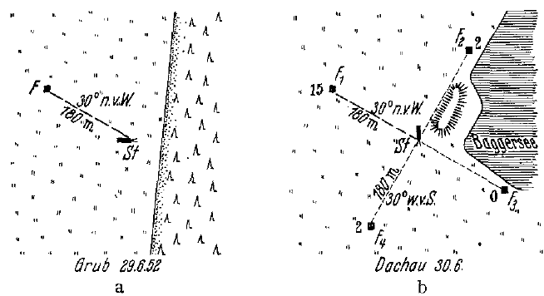
A familiar compass bearing survives hive relocation
Von Frisch and Lindauer trained marked foragers to a feeding location and then moved the hive into an unfamiliar landscape. In their 1952 displacement experiment, the training feeder was 180 m away in a direction 30° north of west. The bees had learned this route during the afternoon.
The following morning, equally familiar scented food dishes were available in four directions in the new landscape. Arriving bees were captured immediately, preventing successful visitors from returning and recruiting nestmates. Searches favored the previously trained compass direction despite the changed terrestrial surroundings.
The result supports compensation for the sun’s movement between afternoon training and morning flight. Across related tests, cloudy conditions could prevent correct orientation when both direct sun and polarized skylight were unavailable. Landmarks and celestial cues can compete; the experiment does not imply that terrestrial information is normally ignored.
von Frisch & Lindauer (1954), Fig. 1a,b. Training and unfamiliar release landscapes.
von Frisch & Lindauer (1954)
04
Notes:
• Von Frisch and Lindauer trained marked foragers to a feeding location and then moved the hive into an unfamiliar landscape. In their 1952 displacement experiment, the training feeder was 180 m away in a direction 30° north of west. The bees had learned this route during the afternoon.
– The four dishes controlled food identity and odor across directions. Capturing arrivals separated an individual’s remembered route from recruitment by another successful bee.
• The following morning, equally familiar scented food dishes were available in four directions in the new landscape. Arriving bees were captured immediately, preventing successful visitors from returning and recruiting nestmates. Searches favored the previously trained compass direction despite the changed terrestrial surroundings.
• The result supports compensation for the sun’s movement between afternoon training and morning flight. Across related tests, cloudy conditions could prevent correct orientation when both direct sun and polarized skylight were unavailable. Landmarks and celestial cues can compete; the experiment does not imply that terrestrial information is normally ignored.
References:
von Frisch K, Lindauer M (1954). Himmel und Erde in Konkurrenz bei der Orientierung der Bienen. Die Naturwissenschaften 41(11): 245-253. https://doi.org/10.1007/bf00634944
Figure: von Frisch & Lindauer (1954), Fig. 1a,b. Training and unfamiliar release landscapes.
Figure source: https://doi.org/10.1007/bf00634944

Slide 5
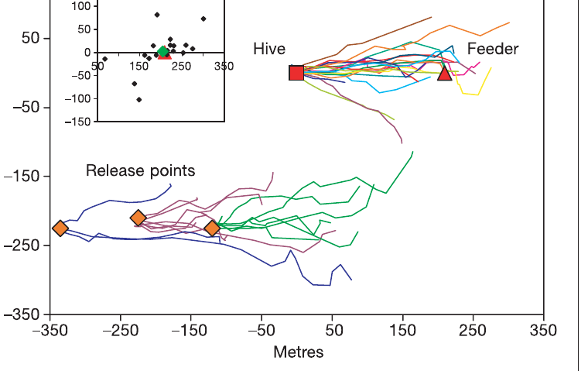
Recruits initially fly the direction advertised in dances
Riley and colleagues tracked bees that had followed dances advertising an unscented feeder 200 m east of the hive. A harmonic radar detects a small transponder carried by the bee, allowing a trajectory to be measured outside the observation hive.
Recruits released at the hive generally flew an initially straight, eastward route. Their straight-flight sections averaged 206 m before searching began. Radar positions were acquired every 3 s, permitting a separation between directed travel and more tortuous search behavior.
The recruits had not previously visited the advertised feeder. The unscented feeding site and the experimental wind direction reduced the possibility of direct odor guidance from the destination. The trajectory supports acquisition of a flight vector from the dance, although radar cannot reveal which sensory components a follower used while attending the dancer.
Riley et al. (2005), Fig. 1. Tracks from hive and displaced release points.
Riley et al. (2005)
05
Notes:
• Riley and colleagues tracked bees that had followed dances advertising an unscented feeder 200 m east of the hive. A harmonic radar detects a small transponder carried by the bee, allowing a trajectory to be measured outside the observation hive.
– The transponder marks the bee’s location, not a neural signal. The initial straight segment and later search were behaviorally defined from the recorded flight.
• Recruits released at the hive generally flew an initially straight, eastward route. Their straight-flight sections averaged 206 m before searching began. Radar positions were acquired every 3 s, permitting a separation between directed travel and more tortuous search behavior.
• The recruits had not previously visited the advertised feeder. The unscented feeding site and the experimental wind direction reduced the possibility of direct odor guidance from the destination. The trajectory supports acquisition of a flight vector from the dance, although radar cannot reveal which sensory components a follower used while attending the dancer.
References:
Riley JR, Greggers U, Smith AD, Reynolds DR, Menzel R (2005). The flight paths of honeybees recruited by the waggle dance. Nature 435(7039): 205-207. https://doi.org/10.1038/nature03526
Figure: Riley et al. (2005), Fig. 1. Tracks from hive and displaced release points.
Figure source: https://doi.org/10.1038/nature03526

Slide 6
Displaced recruits retain a hive-centered flight vector
Riley and colleagues captured dance followers at the hive and released them 200–250 m southwest of it. This manipulation preserved the communicated instruction but changed the point from which the recruit began its flight. The real feeder was no longer 200 m east of the release point.
Displaced bees nevertheless began with an eastward straight flight, averaging 188 m before search. They did not immediately choose the new bearing from the release point toward the actual feeder. The flight instruction therefore retained its direction and approximate distance after displacement.
An origin-dependent vector is useful from its specified origin but leads to a different endpoint when executed elsewhere. This result separates a decoded movement instruction from immediate correction to a world location. It does not exclude later use of familiar landscape information, particularly in environments richer in recognizable landmarks.
Riley et al. (2005), Fig. 1. Tracks from hive and displaced release points.
Riley et al. (2005)
06
Notes:
• Riley and colleagues captured dance followers at the hive and released them 200–250 m southwest of it. This manipulation preserved the communicated instruction but changed the point from which the recruit began its flight. The real feeder was no longer 200 m east of the release point.
– Transport changed the origin without changing the dance. The predicted endpoint for the displaced vector differs from the actual food site.
• Displaced bees nevertheless began with an eastward straight flight, averaging 188 m before search. They did not immediately choose the new bearing from the release point toward the actual feeder. The flight instruction therefore retained its direction and approximate distance after displacement.
• An origin-dependent vector is useful from its specified origin but leads to a different endpoint when executed elsewhere. This result separates a decoded movement instruction from immediate correction to a world location. It does not exclude later use of familiar landscape information, particularly in environments richer in recognizable landmarks.
References:
Riley JR, Greggers U, Smith AD, Reynolds DR, Menzel R (2005). The flight paths of honeybees recruited by the waggle dance. Nature 435(7039): 205-207. https://doi.org/10.1038/nature03526
Figure: Riley et al. (2005), Fig. 1. Tracks from hive and displaced release points.
Figure source: https://doi.org/10.1038/nature03526

Slide 7
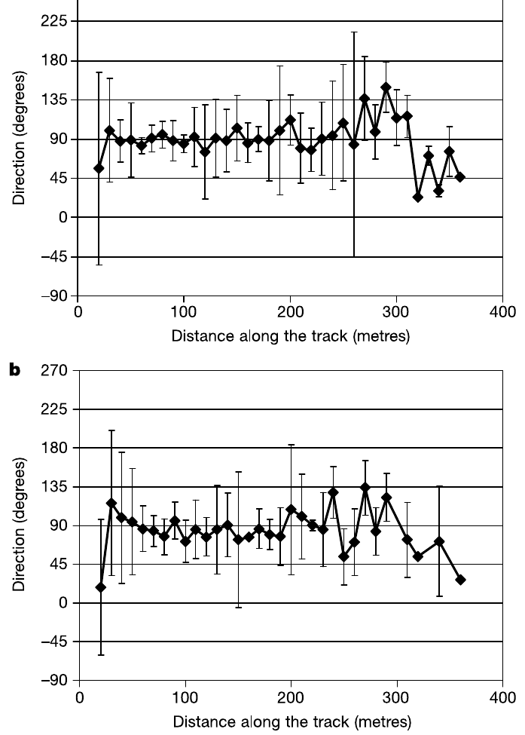
The dance narrows search without pinpointing the feeder
The straight flights of hive-released recruits ended near the advertised feeder on average, but individual endpoints differed by tens of meters. Riley and colleagues then tracked looping searches, some lasting up to 20 min and extending as far as 200 m from the feeding site.
Only two tracked recruits found the unscented feeder. A mean endpoint close to the food location therefore did not imply reliable arrival by every bee. Directional variation increased near the end of the vector flight as directed travel gave way to search.
Dance information supplies an approximate search area. Local visual or odor cues can be needed to resolve the final destination, but the unscented-feeder experiment did not manipulate every possible terminal cue. Spatial scatter and terminal failure distinguish successful long-range information transfer from precise source recognition.
Riley et al. (2005), Fig. 2a,b. Direction changes during initial vector flights.
Riley et al. (2005)
07
Notes:
• The straight flights of hive-released recruits ended near the advertised feeder on average, but individual endpoints differed by tens of meters. Riley and colleagues then tracked looping searches, some lasting up to 20 min and extending as far as 200 m from the feeding site.
– A group average can be close to the feeder even when many individual bees miss it. The search phase is a genuine component of recruitment rather than an error-free continuation of the initial vector.
• Only two tracked recruits found the unscented feeder. A mean endpoint close to the food location therefore did not imply reliable arrival by every bee. Directional variation increased near the end of the vector flight as directed travel gave way to search.
• Dance information supplies an approximate search area. Local visual or odor cues can be needed to resolve the final destination, but the unscented-feeder experiment did not manipulate every possible terminal cue. Spatial scatter and terminal failure distinguish successful long-range information transfer from precise source recognition.
References:
Riley JR, Greggers U, Smith AD, Reynolds DR, Menzel R (2005). The flight paths of honeybees recruited by the waggle dance. Nature 435(7039): 205-207. https://doi.org/10.1038/nature03526
Figure: Riley et al. (2005), Fig. 2a,b. Direction changes during initial vector flights.
Figure source: https://doi.org/10.1038/nature03526

Slide 8
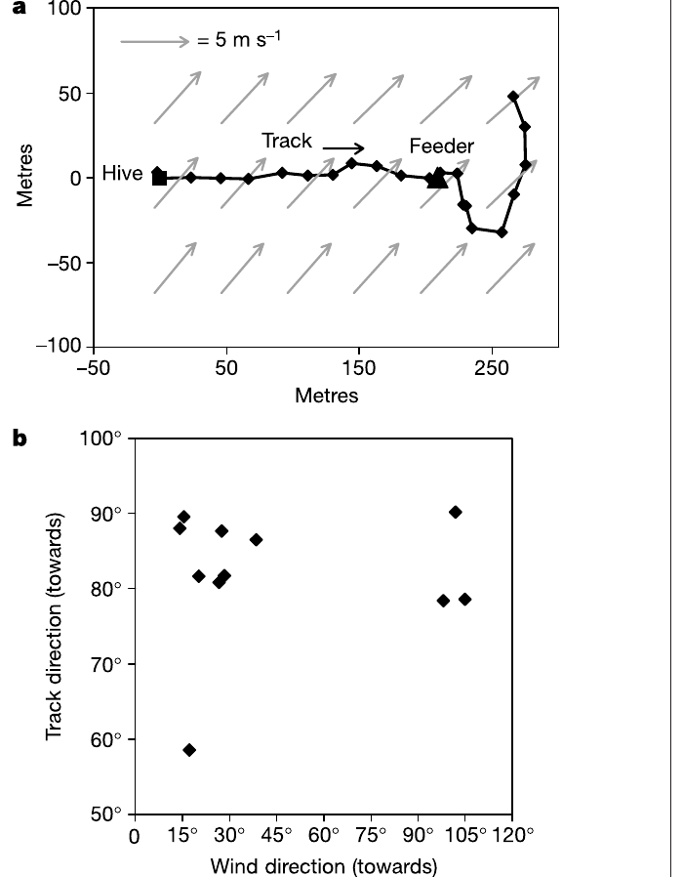
Recruits compensate for drift during crosswind flight
Riley and colleagues measured flight tracks together with wind velocity to distinguish movement over the ground from movement through the air. A bee exposed to a crosswind must direct its body partly into the wind if it is to maintain the advertised ground track.
In one recorded flight, ground speed was 6.8 m/s while a 3.3 m/s wind acted from a different direction. The reconstructed air velocity was 5.2 m/s. The bee’s air heading differed from its ground-track direction by approximately 28°, counteracting wind drift.
The resulting displacement followed the eastward instruction rather than the uncorrected wind-displaced heading. This establishes active compensation during recruitment flight. The wind-and-radar measurements do not isolate the visual or other feedback signals that determine the correction, and a single trajectory is not a universal wind-response calibration.
Riley et al. (2005), Fig. 3a,b. Crosswind compensation during a recruit flight.
Riley et al. (2005)
08
Notes:
• Riley and colleagues measured flight tracks together with wind velocity to distinguish movement over the ground from movement through the air. A bee exposed to a crosswind must direct its body partly into the wind if it is to maintain the advertised ground track.
– Ground velocity combines the bee’s movement through air with air movement over the ground. Distinguishing those quantities prevents heading from being confused with destination direction.
• In one recorded flight, ground speed was 6.8 m/s while a 3.3 m/s wind acted from a different direction. The reconstructed air velocity was 5.2 m/s. The bee’s air heading differed from its ground-track direction by approximately 28°, counteracting wind drift.
• The resulting displacement followed the eastward instruction rather than the uncorrected wind-displaced heading. This establishes active compensation during recruitment flight. The wind-and-radar measurements do not isolate the visual or other feedback signals that determine the correction, and a single trajectory is not a universal wind-response calibration.
References:
Riley JR, Greggers U, Smith AD, Reynolds DR, Menzel R (2005). The flight paths of honeybees recruited by the waggle dance. Nature 435(7039): 205-207. https://doi.org/10.1038/nature03526
Figure: Riley et al. (2005), Fig. 3a,b. Crosswind compensation during a recruit flight.
Figure source: https://doi.org/10.1038/nature03526

Slide 9
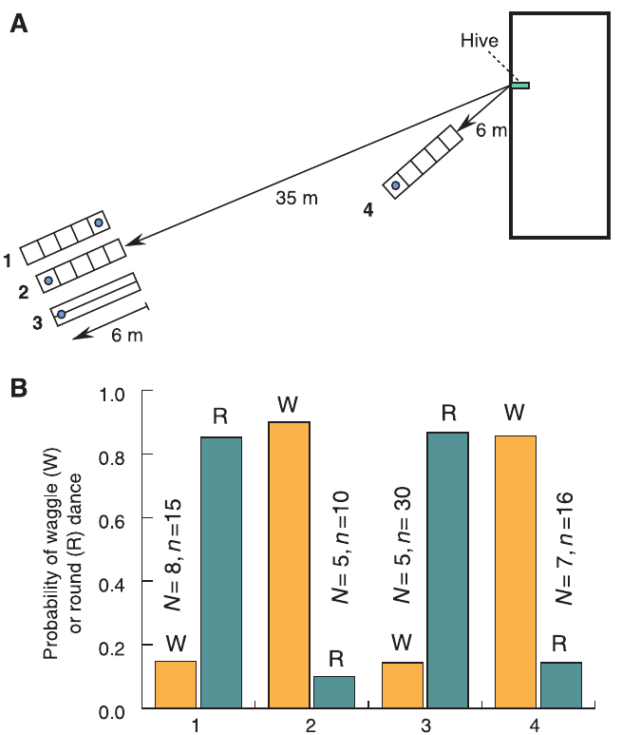
A narrow tunnel magnifies retinal image motion
Optic flow is the movement of environmental images across the retina during self-motion. Nearby surfaces produce more angular image displacement than distant surfaces for the same translational travel. A narrow textured tunnel therefore increases optic flow without requiring a long physical flight.
Srinivasan and colleagues trained honeybees through a tunnel 6.4 m long, 11 cm wide and 20 cm high. Random black-and-white texture covered the walls and floor; a mesh ceiling allowed a view of the sky. The feeder was positioned 6 m into the tunnel.
Returning bees produced waggle dances after this short passage even when an equally short outdoor journey normally elicited round dances. The preparation separates physical distance from visual motion experienced en route. It supports a visual odometer, a mechanism estimating distance traveled, rather than an exclusively energy-based distance measure.
Srinivasan et al. (2000), Fig. 1A,B. Tunnel geometry and texture-dependent dances.
Srinivasan et al. (2000)
09
Notes:
• Optic flow is the movement of environmental images across the retina during self-motion. Nearby surfaces produce more angular image displacement than distant surfaces for the same translational travel. A narrow textured tunnel therefore increases optic flow without requiring a long physical flight.
– The tunnel dimensions matter because proximity changes angular image speed. The feeder location and tunnel texture were controlled independently.
• Srinivasan and colleagues trained honeybees through a tunnel 6.4 m long, 11 cm wide and 20 cm high. Random black-and-white texture covered the walls and floor; a mesh ceiling allowed a view of the sky. The feeder was positioned 6 m into the tunnel.
• Returning bees produced waggle dances after this short passage even when an equally short outdoor journey normally elicited round dances. The preparation separates physical distance from visual motion experienced en route. It supports a visual odometer, a mechanism estimating distance traveled, rather than an exclusively energy-based distance measure.
References:
Srinivasan MV, Zhang S, Altwein M, Tautz J (2000). Honeybee Navigation: Nature and Calibration of the "Odometer". Science 287(5454): 851-853. https://doi.org/10.1126/science.287.5454.851
Figure: Srinivasan et al. (2000), Fig. 1A,B. Tunnel geometry and texture-dependent dances.
Figure source: https://doi.org/10.1126/science.287.5454.851

Slide 10
Axial stripes remove the tunnel’s distance inflation
Srinivasan and colleagues kept the feeder at the same physical location while replacing random tunnel texture with stripes parallel to flight. Axial stripes change little along the flight axis, reducing the visual motion normally generated by forward travel.
A 35 m outdoor journey followed by 6 m through random texture produced waggle dances in 90% of recorded dances. With axial stripes at the same total distance of 41 m, 86.7% of dances were round dances. Without the tunnel, a feeder at 35 m elicited predominantly round dances.
Physical journey length cannot explain the difference between the two 41 m preparations. The texture control identifies optic flow as the relevant variable under these conditions. It does not establish that all visual patterns are equally effective or that energetic state never affects other aspects of dancing.
Srinivasan et al. (2000), Fig. 1A,B. Tunnel geometry and texture-dependent dances.
Srinivasan et al. (2000)
10
Notes:
• Srinivasan and colleagues kept the feeder at the same physical location while replacing random tunnel texture with stripes parallel to flight. Axial stripes change little along the flight axis, reducing the visual motion normally generated by forward travel.
– Parallel stripes and random texture impose different visual motion while preserving the target location. The comparison addresses distance estimation rather than reward quality.
• A 35 m outdoor journey followed by 6 m through random texture produced waggle dances in 90% of recorded dances. With axial stripes at the same total distance of 41 m, 86.7% of dances were round dances. Without the tunnel, a feeder at 35 m elicited predominantly round dances.
• Physical journey length cannot explain the difference between the two 41 m preparations. The texture control identifies optic flow as the relevant variable under these conditions. It does not establish that all visual patterns are equally effective or that energetic state never affects other aspects of dancing.
References:
Srinivasan MV, Zhang S, Altwein M, Tautz J (2000). Honeybee Navigation: Nature and Calibration of the "Odometer". Science 287(5454): 851-853. https://doi.org/10.1126/science.287.5454.851
Figure: Srinivasan et al. (2000), Fig. 1A,B. Tunnel geometry and texture-dependent dances.
Figure source: https://doi.org/10.1126/science.287.5454.851

Slide 11
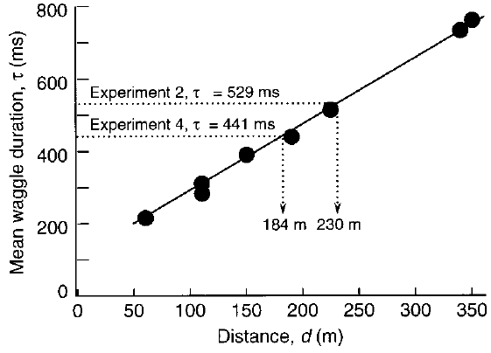
Outdoor dances calibrate the duration–distance relation
Srinivasan and colleagues moved outdoor feeders between 60 and 350 m and measured the duration of each waggle phase on return to the hive. Over this range, mean waggle duration increased approximately linearly with feeder distance.
The reported calibration increased by 1.88 ms of waggle duration per meter of outdoor travel. It provided a reference for interpreting the unusually long dances produced after textured-tunnel flights. The calibration was measured independently of the tunnel manipulation.
A calibration relates a measured signal to a known quantity under specified conditions. It is not necessarily a universal conversion applicable to every landscape or colony. The outdoor measurements establish the relation for the tested routes and distances; they do not identify the neurons integrating optic flow or storing the resulting distance estimate.
Srinivasan et al. (2000), Fig. 2. Outdoor distance calibration of waggle duration.
Srinivasan et al. (2000)
11
Notes:
• Srinivasan and colleagues moved outdoor feeders between 60 and 350 m and measured the duration of each waggle phase on return to the hive. Over this range, mean waggle duration increased approximately linearly with feeder distance.
– Duration is the measured motor output. The experimental outdoor calibration gives it a distance interpretation without treating a tunnel flight as an ordinary outdoor flight.
• The reported calibration increased by 1.88 ms of waggle duration per meter of outdoor travel. It provided a reference for interpreting the unusually long dances produced after textured-tunnel flights. The calibration was measured independently of the tunnel manipulation.
• A calibration relates a measured signal to a known quantity under specified conditions. It is not necessarily a universal conversion applicable to every landscape or colony. The outdoor measurements establish the relation for the tested routes and distances; they do not identify the neurons integrating optic flow or storing the resulting distance estimate.
References:
Srinivasan MV, Zhang S, Altwein M, Tautz J (2000). Honeybee Navigation: Nature and Calibration of the "Odometer". Science 287(5454): 851-853. https://doi.org/10.1126/science.287.5454.851
Figure: Srinivasan et al. (2000), Fig. 2. Outdoor distance calibration of waggle duration.
Figure source: https://doi.org/10.1126/science.287.5454.851

Slide 12
Six tunnel meters can signal a much longer journey
Srinivasan and colleagues used the outdoor calibration to interpret dances following textured-tunnel passages. A 41 m journey containing 6 m inside the tunnel produced a mean waggle duration of 528.8 ms, corresponding to approximately 230 m in the outdoor calibration.
A second arrangement placed the tunnel nearer the hive, producing only 12 m of total travel. Its mean duration was 441.2 ms, corresponding to approximately 184 m outdoors. Both preparations generated a disproportionately large distance signal despite their different outdoor approach lengths.
The close textured surfaces amplified the visually measured journey. The comparison rejects a simple account in which waggle duration reports physical meters independently of visual surroundings. These inferred outdoor distances are values from the authors’ calibration, not direct measurements of a bee’s subjective experience.
Srinivasan et al. (2000), Fig. 2. Outdoor distance calibration of waggle duration.
Srinivasan et al. (2000)
12
Notes:
• Srinivasan and colleagues used the outdoor calibration to interpret dances following textured-tunnel passages. A 41 m journey containing 6 m inside the tunnel produced a mean waggle duration of 528.8 ms, corresponding to approximately 230 m in the outdoor calibration.
– The two tunnel conditions were mapped onto the published outdoor relation. They establish a visual dependence of the signal, without requiring a verbal attribution of perceived meters to the bee.
• A second arrangement placed the tunnel nearer the hive, producing only 12 m of total travel. Its mean duration was 441.2 ms, corresponding to approximately 184 m outdoors. Both preparations generated a disproportionately large distance signal despite their different outdoor approach lengths.
• The close textured surfaces amplified the visually measured journey. The comparison rejects a simple account in which waggle duration reports physical meters independently of visual surroundings. These inferred outdoor distances are values from the authors’ calibration, not direct measurements of a bee’s subjective experience.
References:
Srinivasan MV, Zhang S, Altwein M, Tautz J (2000). Honeybee Navigation: Nature and Calibration of the "Odometer". Science 287(5454): 851-853. https://doi.org/10.1126/science.287.5454.851
Figure: Srinivasan et al. (2000), Fig. 2. Outdoor distance calibration of waggle duration.
Figure source: https://doi.org/10.1126/science.287.5454.851

Slide 13
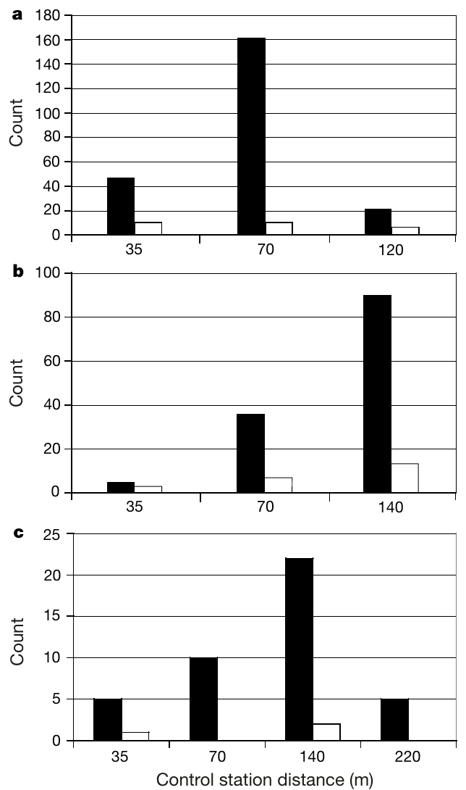
Followers search at the distance encoded by tunnel dances
Esch and colleagues trained dancers to fly 3 m outdoors and then through an 8 m textured tunnel toward the south. Although the actual feeder was only 11 m from the hive, returning bees produced waggle runs averaging 358 ms.
The local outdoor calibration associated this duration with approximately 72 m. Newly recruited bees searched predominantly at a control station 70 m south of the hive rather than at the tunnel feeder. Control stations offered neither food reward nor an added scent.
For the first 30 min, the tunnel was closed: dancers did not advertise the tunnel journey and recruits did not arrive at the stations. Opening it initiated dancing and subsequent recruitment. This links the visually inflated distance signal to followers’ search behavior, rather than merely to a change in the dancer’s movements.
Esch et al. (2001), Fig. 2a–c. Recruit searches after tunnel-distance dances.
Esch et al. (2001)
13
Notes:
• Esch and colleagues trained dancers to fly 3 m outdoors and then through an 8 m textured tunnel toward the south. Although the actual feeder was only 11 m from the hive, returning bees produced waggle runs averaging 358 ms.
– Bees arriving at control stations were captured so their own return dances could not create additional recruitment to the station. The search behavior tests decoding independently of the dancer’s physical flight length.
• The local outdoor calibration associated this duration with approximately 72 m. Newly recruited bees searched predominantly at a control station 70 m south of the hive rather than at the tunnel feeder. Control stations offered neither food reward nor an added scent.
• For the first 30 min, the tunnel was closed: dancers did not advertise the tunnel journey and recruits did not arrive at the stations. Opening it initiated dancing and subsequent recruitment. This links the visually inflated distance signal to followers’ search behavior, rather than merely to a change in the dancer’s movements.
References:
Esch HE, Zhang S, Srinivasan MV, Tautz J (2001). Honeybee dances communicate distances measured by optic flow. Nature 411(6837): 581-583. https://doi.org/10.1038/35079072
Figure: Esch et al. (2001), Fig. 2a–c. Recruit searches after tunnel-distance dances.
Figure source: https://doi.org/10.1038/35079072

Slide 14
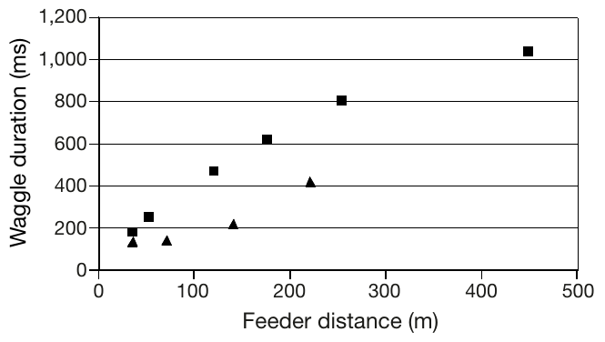
Outdoor calibration differs between flight routes
Esch and colleagues measured outdoor dance durations separately for southern and northwestern routes. A given waggle duration corresponded to different physical distances on the two routes, even though both involved ordinary outdoor flight.
For example, 270 ms corresponded to about 52 m using the southern relation but about 157 m using the northwestern relation. The northwestern landscape generated less distance signal per physical meter than the southern landscape. A single route-independent conversion would therefore misread the dance.
The relevant quantity is accumulated visual motion shaped by the route. Terrain and viewing geometry can change the relation between optic flow and physical distance. The calibration experiment does not identify the exact contribution of every landmark, but it establishes that the environmental dependence matters when comparing advertised and searched distances.
Esch et al. (2001), Fig. 1. Outdoor calibration of dance duration.
Esch et al. (2001)
14
Notes:
• Esch and colleagues measured outdoor dance durations separately for southern and northwestern routes. A given waggle duration corresponded to different physical distances on the two routes, even though both involved ordinary outdoor flight.
– The published graph distinguishes southern squares from northwestern triangles. Duration can carry a reliable route-specific instruction even when physical meters differ between routes.
• For example, 270 ms corresponded to about 52 m using the southern relation but about 157 m using the northwestern relation. The northwestern landscape generated less distance signal per physical meter than the southern landscape. A single route-independent conversion would therefore misread the dance.
• The relevant quantity is accumulated visual motion shaped by the route. Terrain and viewing geometry can change the relation between optic flow and physical distance. The calibration experiment does not identify the exact contribution of every landmark, but it establishes that the environmental dependence matters when comparing advertised and searched distances.
References:
Esch HE, Zhang S, Srinivasan MV, Tautz J (2001). Honeybee dances communicate distances measured by optic flow. Nature 411(6837): 581-583. https://doi.org/10.1038/35079072
Figure: Esch et al. (2001), Fig. 1. Outdoor calibration of dance duration.
Figure source: https://doi.org/10.1038/35079072

Slide 15
Northwestern recruits use their route’s visual calibration
Esch and colleagues repeated the tunnel recruitment test with a northwestern approach: 3 m outdoors followed by 6 m through the tunnel. The actual feeder was 9 m away, and returning dancers produced waggle runs averaging 270 ms.
Recruit searches peaked near 140 m along the northwestern route. The northwestern outdoor calibration predicted approximately 157 m, whereas applying the southern calibration would predict only about 52 m. Recruits therefore searched where a route-appropriate visual-distance interpretation placed the destination.
Stations were unrewarded, and closing the tunnel before each experiment prevented the relevant dances and recruitment. The result connects dance decoding with followers’ own visual navigation. It does not establish a permanently fixed distance dictionary: the conversion depends on the visual conditions encountered by the navigating bees.
Esch et al. (2001), Fig. 2a–c. Recruit searches after tunnel-distance dances.
Esch et al. (2001)
15
Notes:
• Esch and colleagues repeated the tunnel recruitment test with a northwestern approach: 3 m outdoors followed by 6 m through the tunnel. The actual feeder was 9 m away, and returning dancers produced waggle runs averaging 270 ms.
– The tunnel-distance instruction can be shared because dancer and follower navigate comparable visual terrain. The physical feeder distance and the searched distance remain experimentally distinct.
• Recruit searches peaked near 140 m along the northwestern route. The northwestern outdoor calibration predicted approximately 157 m, whereas applying the southern calibration would predict only about 52 m. Recruits therefore searched where a route-appropriate visual-distance interpretation placed the destination.
• Stations were unrewarded, and closing the tunnel before each experiment prevented the relevant dances and recruitment. The result connects dance decoding with followers’ own visual navigation. It does not establish a permanently fixed distance dictionary: the conversion depends on the visual conditions encountered by the navigating bees.
References:
Esch HE, Zhang S, Srinivasan MV, Tautz J (2001). Honeybee dances communicate distances measured by optic flow. Nature 411(6837): 581-583. https://doi.org/10.1038/35079072
Figure: Esch et al. (2001), Fig. 2a–c. Recruit searches after tunnel-distance dances.
Figure source: https://doi.org/10.1038/35079072

Slide 16
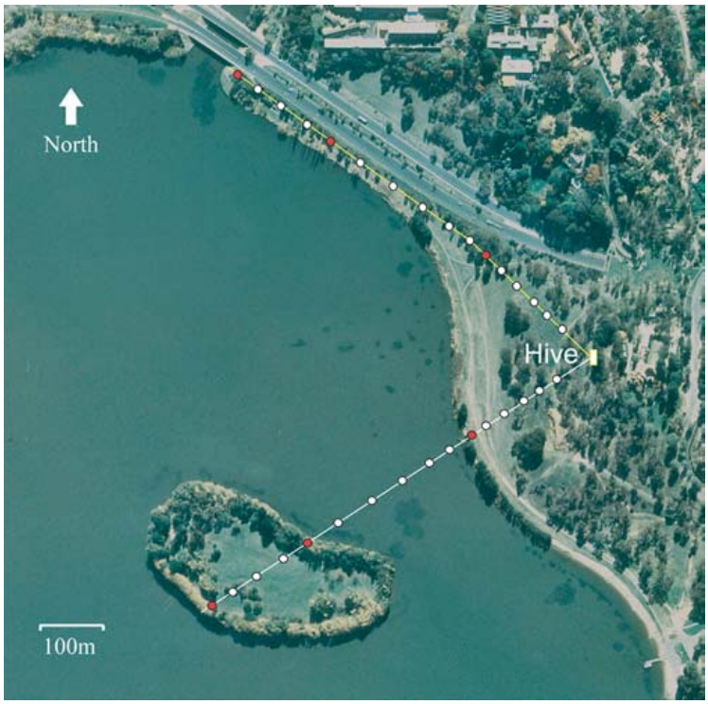
Natural water crossings alter the distance signal
Tautz and colleagues moved feeders along two routes, each 580 m long. One route crossed land, water and then an island; the other remained over land. Marked foragers were trained to follow the moving food source, including a feeder carried by boat.
For each position, returning dances were filmed and waggle-run duration measured. The experiment tested whether the tunnel-defined visual odometer also depended on natural terrain. Both routes increased physical distance without the artificial proximity of tunnel walls.
Water-crossing bees continued to signal increasing distance, but the rate of increase differed across route segments. Recruits were scarce while the feeder was over water and reappeared on the island. Recruitment success and distance encoding are related but distinct outcomes, and the habitat change can affect both.
Tautz et al. (2004), Fig. 1. Land, water and island routes.
Tautz et al. (2004)
16
Notes:
• Tautz and colleagues moved feeders along two routes, each 580 m long. One route crossed land, water and then an island; the other remained over land. Marked foragers were trained to follow the moving food source, including a feeder carried by boat.
– Maintaining trained bees at the boat feeder allowed distance signals to be measured even when spontaneous recruitment onto the water was uncommon.
• For each position, returning dances were filmed and waggle-run duration measured. The experiment tested whether the tunnel-defined visual odometer also depended on natural terrain. Both routes increased physical distance without the artificial proximity of tunnel walls.
• Water-crossing bees continued to signal increasing distance, but the rate of increase differed across route segments. Recruits were scarce while the feeder was over water and reappeared on the island. Recruitment success and distance encoding are related but distinct outcomes, and the habitat change can affect both.
References:
Tautz J, Zhang S, Spaethe J, Brockmann A, Si A, Srinivasan M (2004). Honeybee Odometry: Performance in Varying Natural Terrain. PLoS Biology 2(7): e211. https://doi.org/10.1371/journal.pbio.0020211
Figure: Tautz et al. (2004), Fig. 1. Land, water and island routes.
Figure source: https://doi.org/10.1371/journal.pbio.0020211

Slide 17
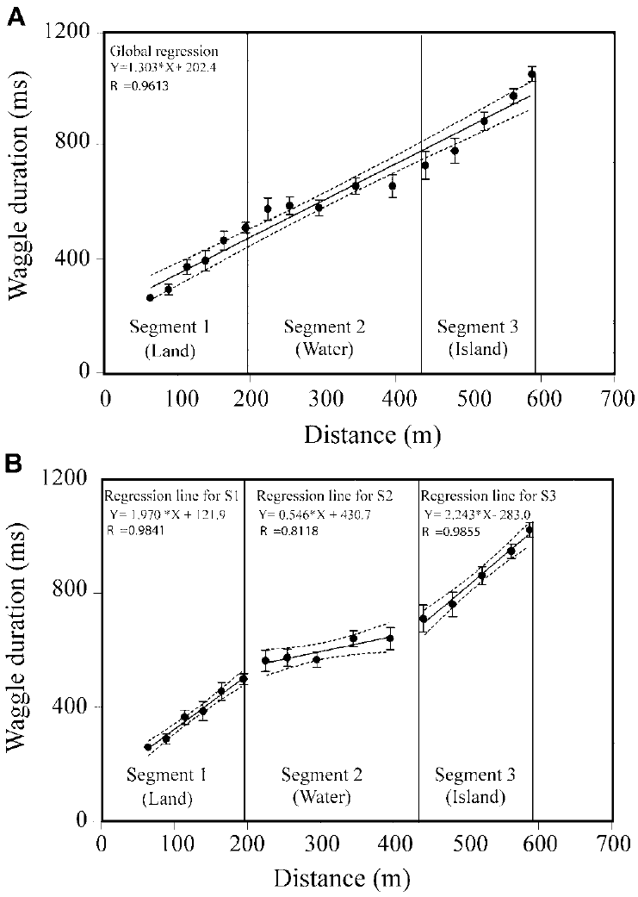
Waggle duration accumulates more slowly over water
On the land–water–island route, Tautz and colleagues measured a waggle-duration increase of 1.970 ms/m over the first land segment, 0.546 ms/m over water and 2.243 ms/m over the island. Equal increments of physical travel therefore contributed unequally to the dance signal.
Segment-specific relations captured the change more closely than a single constant slope across the whole route. An all-land comparison route lacked a corresponding water-associated flattening. The control separated a specific terrain transition from a general dependence on increasing feeder distance.
A visual odometer need not stop working over water; it can accumulate less effective image motion there. These behavioral measurements constrain the distance signal’s input dependence. They do not directly record retinal motion neurons or prove that low contrast alone accounts for the entire water effect.
Tautz et al. (2004), Fig. 2A,B. Distance coding changes over water.
Tautz et al. (2004)
17
Notes:
• On the land–water–island route, Tautz and colleagues measured a waggle-duration increase of 1.970 ms/m over the first land segment, 0.546 ms/m over water and 2.243 ms/m over the island. Equal increments of physical travel therefore contributed unequally to the dance signal.
– The units are milliseconds of additional waggle duration per physical meter. A flatter slope means less signal increment, not necessarily a lower flight speed.
• Segment-specific relations captured the change more closely than a single constant slope across the whole route. An all-land comparison route lacked a corresponding water-associated flattening. The control separated a specific terrain transition from a general dependence on increasing feeder distance.
• A visual odometer need not stop working over water; it can accumulate less effective image motion there. These behavioral measurements constrain the distance signal’s input dependence. They do not directly record retinal motion neurons or prove that low contrast alone accounts for the entire water effect.
References:
Tautz J, Zhang S, Spaethe J, Brockmann A, Si A, Srinivasan M (2004). Honeybee Odometry: Performance in Varying Natural Terrain. PLoS Biology 2(7): e211. https://doi.org/10.1371/journal.pbio.0020211
Figure: Tautz et al. (2004), Fig. 2A,B. Distance coding changes over water.
Figure source: https://doi.org/10.1371/journal.pbio.0020211

Slide 18
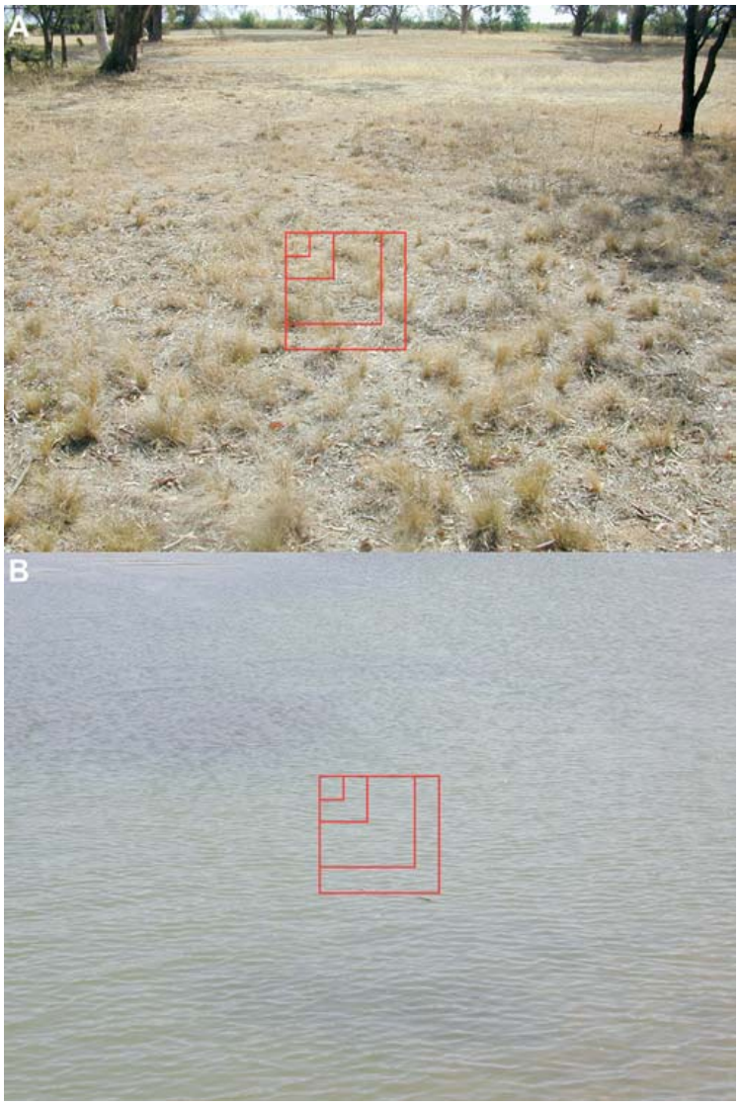
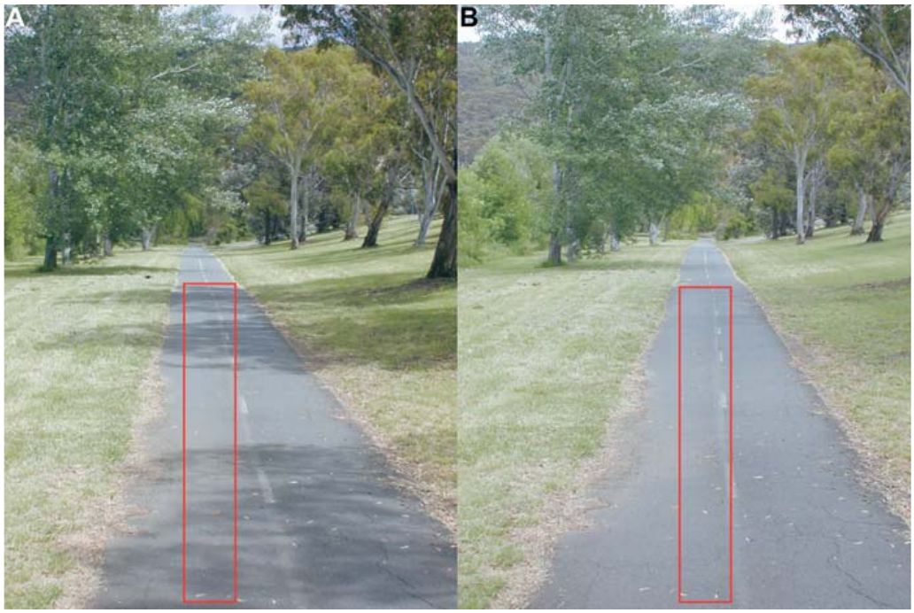
Image contrast constrains natural visual odometry
Visual contrast measures differences in image intensity that make spatial structure detectable. Tautz and colleagues photographed land and water scenes along the experimental routes and analyzed intensity variation in defined image windows.
Mean contrast was greater over land than over water. The low-contrast water segment coincided with slower accumulation of waggle duration, whereas the terrestrial segments supported larger increases. The original scene photographs retain the investigators’ measurement windows.
Contrast provides a plausible connection between natural image structure and effective optic flow. A correlation across route segments does not isolate contrast from flight height, viewing direction or surface texture. The controlled tunnel-texture experiments supply a separate intervention on visual motion, while the field measurements establish ecological dependence under ordinary foraging conditions.
Tautz et al. (2004), Fig. 4. Scenes used to compare land and water contrast.
Tautz et al. (2004), Fig. 5. Natural terrestrial route and image-analysis windows.
Tautz et al. (2004); Srinivasan et al. (2000)
18
Notes:
• Visual contrast measures differences in image intensity that make spatial structure detectable. Tautz and colleagues photographed land and water scenes along the experimental routes and analyzed intensity variation in defined image windows.
– Low contrast can weaken motion signals even when the animal continues moving. The photographs document the actual terrain; they are not a reconstructed visual stimulus.
• Mean contrast was greater over land than over water. The low-contrast water segment coincided with slower accumulation of waggle duration, whereas the terrestrial segments supported larger increases. The original scene photographs retain the investigators’ measurement windows.
• Contrast provides a plausible connection between natural image structure and effective optic flow. A correlation across route segments does not isolate contrast from flight height, viewing direction or surface texture. The controlled tunnel-texture experiments supply a separate intervention on visual motion, while the field measurements establish ecological dependence under ordinary foraging conditions.
References:
Tautz J, Zhang S, Spaethe J, Brockmann A, Si A, Srinivasan M (2004). Honeybee Odometry: Performance in Varying Natural Terrain. PLoS Biology 2(7): e211. https://doi.org/10.1371/journal.pbio.0020211
Srinivasan MV, Zhang S, Altwein M, Tautz J (2000). Honeybee Navigation: Nature and Calibration of the "Odometer". Science 287(5454): 851-853. https://doi.org/10.1126/science.287.5454.851
Figure: Tautz et al. (2004), Fig. 4. Scenes used to compare land and water contrast.
Figure source: https://doi.org/10.1371/journal.pbio.0020211
Figure: Tautz et al. (2004), Fig. 5. Natural terrestrial route and image-analysis windows.
Figure source: https://doi.org/10.1371/journal.pbio.0020211

Slide 19
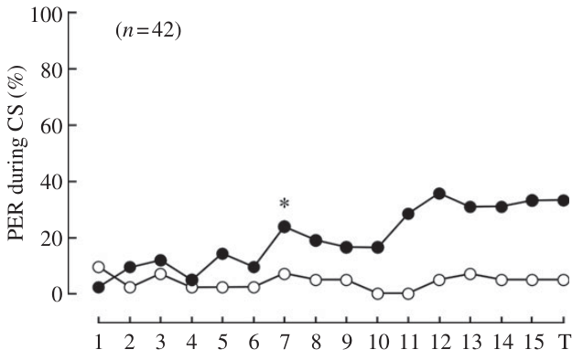
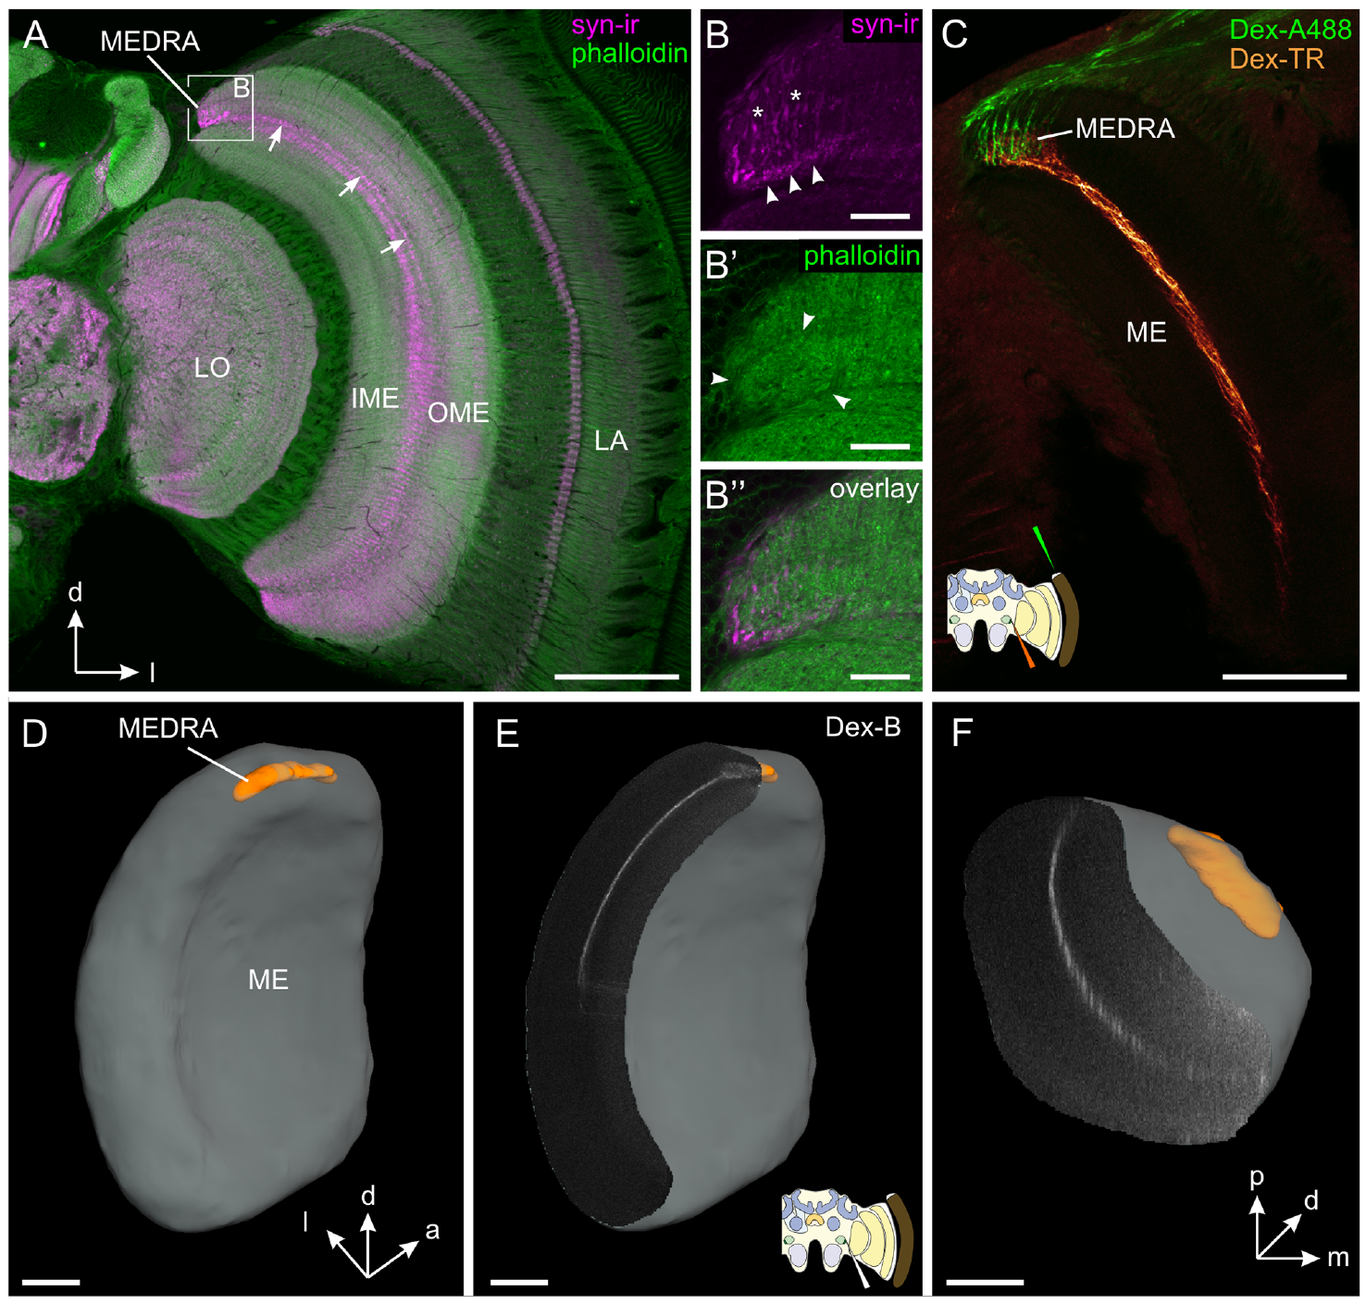
Bees can learn the orientation of polarized light
Polarized light has a preferred orientation of its electric-field oscillation, called the e-vector. Sakura and colleagues tested whether restrained honeybees could discriminate two e-vector directions presented from above without having to complete a navigational journey.
One direction was paired with sucrose; the perpendicular direction was not rewarded. The proboscis extension response, extension of the feeding mouthparts, supplied a behavioral readout of association. During ultraviolet-light conditioning, responses increased to the rewarded direction while remaining low to the other.
Sakura et al. (2012), Fig. 1. Rewarded and unrewarded polarization directions.
Zeller et al. (2015), Fig. 1A–F. Dorsal-rim input reaches dorsal medulla.
The test establishes learned discrimination of polarization orientation independently of free-flight steering. Head-fixed bees could also learn, supporting detection without repeated active head scanning. It does not measure an internal compass bearing or establish how this sensory discrimination is converted into the direction advertised in a dance.
Sakura et al. (2012)
19
Notes:
• Polarized light has a preferred orientation of its electric-field oscillation, called the e-vector. Sakura and colleagues tested whether restrained honeybees could discriminate two e-vector directions presented from above without having to complete a navigational journey.
– Rewarded and unrewarded directions differed by 90°. The dorsal-rim anatomy is from Zeller and colleagues; it identifies the sensory entry region investigated with occlusion in Sakura’s behavioral preparation.
• One direction was paired with sucrose; the perpendicular direction was not rewarded. The proboscis extension response, extension of the feeding mouthparts, supplied a behavioral readout of association. During ultraviolet-light conditioning, responses increased to the rewarded direction while remaining low to the other.
• The test establishes learned discrimination of polarization orientation independently of free-flight steering. Head-fixed bees could also learn, supporting detection without repeated active head scanning. It does not measure an internal compass bearing or establish how this sensory discrimination is converted into the direction advertised in a dance.
References:
Sakura M, Okada R, Aonuma H (2012). Evidence for instantaneous e-vector detection in the honeybee using an associative learning paradigm. Proceedings of the Royal Society B: Biological Sciences 279(1728): 535-542. https://doi.org/10.1098/rspb.2011.0929
Zeller M, Held M, Bender J, Berz A, Heinloth T, Hellfritz T, Pfeiffer K (2015). Transmedulla Neurons in the Sky Compass Network of the Honeybee (Apis mellifera) Are a Possible Site of Circadian Input. PLOS ONE 10(12): e0143244. https://doi.org/10.1371/journal.pone.0143244
Figure: Sakura et al. (2012), Fig. 1. Rewarded and unrewarded polarization directions.
Figure source: https://doi.org/10.1098/rspb.2011.0929
Figure: Zeller et al. (2015), Fig. 1A–F. Dorsal-rim input reaches dorsal medulla.
Figure source: https://doi.org/10.1371/journal.pone.0143244

Slide 20
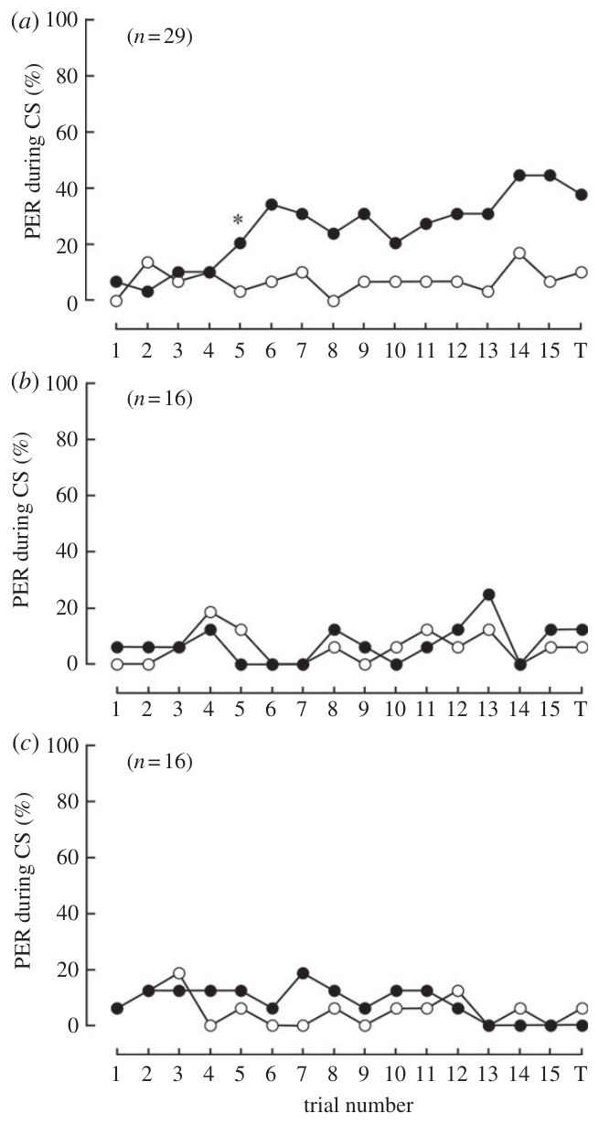
Polarization learning depends on ultraviolet stimulation
Sakura and colleagues repeated polarization conditioning with ultraviolet light near 350 nm, blue light near 442 nm and green light near 546 nm. Each preparation used a rewarded e-vector and a perpendicular unrewarded e-vector.
Bees acquired the discrimination under ultraviolet stimulation but did not acquire it under the tested blue or green conditions. The wavelength comparison controlled the form of the associative task while changing the available spectral input. Ordinary responsiveness to sucrose was assessed separately.
Zeller et al. (2015), Fig. 1A–F. Dorsal-rim input reaches dorsal medulla.
The result is consistent with ultraviolet-sensitive polarization input rather than a wavelength-independent task solution. It does not mean that blue and green receptors are unimportant in other visual behaviors. Nor does this behavioral experiment identify an individual phototransduction ion channel or trace a complete polarization-processing circuit.
Sakura et al. (2012), Fig. 3a–c. Learning with ultraviolet, blue and green light.
Sakura et al. (2012)
20
Notes:
• Sakura and colleagues repeated polarization conditioning with ultraviolet light near 350 nm, blue light near 442 nm and green light near 546 nm. Each preparation used a rewarded e-vector and a perpendicular unrewarded e-vector.
– The three wavelength conditions isolate spectral dependence. The source anatomy places dorsal-rim inputs in the dorsal medulla, but wavelength-dependent learning itself was measured behaviorally.
• Bees acquired the discrimination under ultraviolet stimulation but did not acquire it under the tested blue or green conditions. The wavelength comparison controlled the form of the associative task while changing the available spectral input. Ordinary responsiveness to sucrose was assessed separately.
• The result is consistent with ultraviolet-sensitive polarization input rather than a wavelength-independent task solution. It does not mean that blue and green receptors are unimportant in other visual behaviors. Nor does this behavioral experiment identify an individual phototransduction ion channel or trace a complete polarization-processing circuit.
References:
Sakura M, Okada R, Aonuma H (2012). Evidence for instantaneous e-vector detection in the honeybee using an associative learning paradigm. Proceedings of the Royal Society B: Biological Sciences 279(1728): 535-542. https://doi.org/10.1098/rspb.2011.0929
Zeller M, Held M, Bender J, Berz A, Heinloth T, Hellfritz T, Pfeiffer K (2015). Transmedulla Neurons in the Sky Compass Network of the Honeybee (Apis mellifera) Are a Possible Site of Circadian Input. PLOS ONE 10(12): e0143244. https://doi.org/10.1371/journal.pone.0143244
Figure: Sakura et al. (2012), Fig. 3a–c. Learning with ultraviolet, blue and green light.
Figure source: https://doi.org/10.1098/rspb.2011.0929
Figure: Zeller et al. (2015), Fig. 1A–F. Dorsal-rim input reaches dorsal medulla.
Figure source: https://doi.org/10.1371/journal.pone.0143244

Slide 21
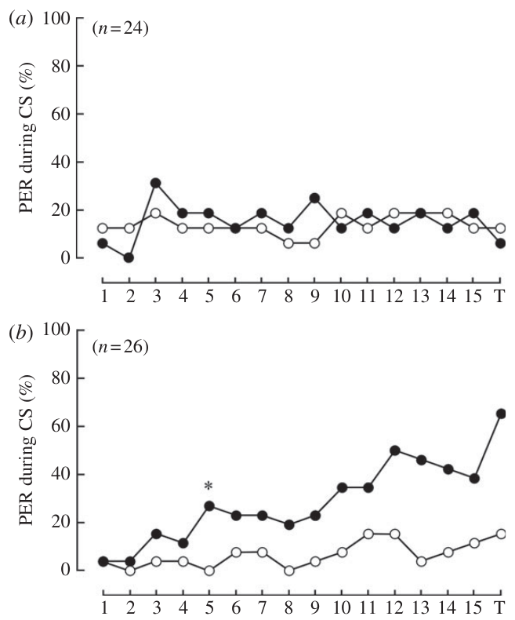
Occluding the dorsal rim removes e-vector learning
The dorsal rim area is a specialized region near the upper edge of the compound eye associated with skylight polarization detection. Sakura and colleagues painted either this region or the rest of the eye before ultraviolet polarization conditioning.
Bees with the dorsal rim covered did not learn the rewarded e-vector. Bees with the extradorsal-rim region covered retained discrimination, despite having much of the eye occluded. This complementary control links the behavioral effect to the specialized region rather than simply to reduced exposed eye area.
Zeller et al. (2015), Fig. 1A–F. Dorsal-rim input reaches dorsal medulla.
The experiment supports a necessary dorsal-rim contribution under these conditions. Zeller and colleagues traced input from this region into a specialized dorsal-medulla compartment. The occlusion and tracing results converge on a sensory pathway, but neither establishes every receptor subtype or the downstream synapses required for dance navigation.
Sakura et al. (2012), Fig. 2a,b. Dorsal-rim occlusion and extradorsal-rim controls.
Sakura et al. (2012); Zeller et al. (2015)
21
Notes:
• The dorsal rim area is a specialized region near the upper edge of the compound eye associated with skylight polarization detection. Sakura and colleagues painted either this region or the rest of the eye before ultraviolet polarization conditioning.
– The extradorsal-rim condition leaves the candidate polarization-sensitive region available. This is a stronger localization control than covering the whole eye.
• Bees with the dorsal rim covered did not learn the rewarded e-vector. Bees with the extradorsal-rim region covered retained discrimination, despite having much of the eye occluded. This complementary control links the behavioral effect to the specialized region rather than simply to reduced exposed eye area.
• The experiment supports a necessary dorsal-rim contribution under these conditions. Zeller and colleagues traced input from this region into a specialized dorsal-medulla compartment. The occlusion and tracing results converge on a sensory pathway, but neither establishes every receptor subtype or the downstream synapses required for dance navigation.
References:
Sakura M, Okada R, Aonuma H (2012). Evidence for instantaneous e-vector detection in the honeybee using an associative learning paradigm. Proceedings of the Royal Society B: Biological Sciences 279(1728): 535-542. https://doi.org/10.1098/rspb.2011.0929
Zeller M, Held M, Bender J, Berz A, Heinloth T, Hellfritz T, Pfeiffer K (2015). Transmedulla Neurons in the Sky Compass Network of the Honeybee (Apis mellifera) Are a Possible Site of Circadian Input. PLOS ONE 10(12): e0143244. https://doi.org/10.1371/journal.pone.0143244
Figure: Sakura et al. (2012), Fig. 2a,b. Dorsal-rim occlusion and extradorsal-rim controls.
Figure source: https://doi.org/10.1098/rspb.2011.0929
Figure: Zeller et al. (2015), Fig. 1A–F. Dorsal-rim input reaches dorsal medulla.
Figure source: https://doi.org/10.1371/journal.pone.0143244

Slide 22
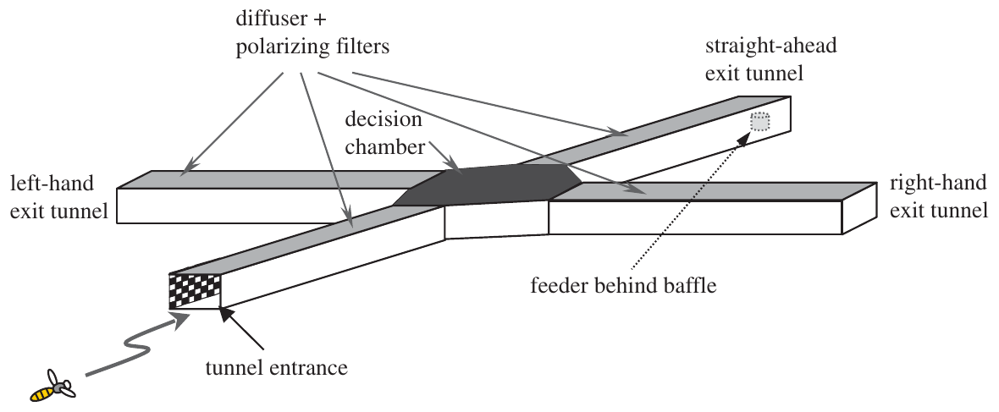
Polarized illumination can label a learned flight route
Kraft and colleagues trained bees in a four-tunnel maze with one entrance and three possible exits. Each tunnel was 125 cm long, 11 cm wide and 18 cm high. Polarizing filters above the tunnels specified illumination parallel or perpendicular to the flight axis.
The rewarded exit carried the same relative polarization orientation as the entrance. Incorrect exits offered no reward; during tests, choices were measured without reward. A diffuser prevented a direct view of the sun and obscured overhead landmarks.
Kraft et al. (2011), Fig. 1. Four-tunnel polarized-light maze.
The preparation asks whether a bee can associate a route with a particular relationship between body axis and e-vector. It does not require an absolute geographical compass solution. Moving the illumination pattern among exits then tests the contribution of polarization against a learned preference for turning or going straight.
Kraft et al. (2011)
22
Notes:
• Kraft and colleagues trained bees in a four-tunnel maze with one entrance and three possible exits. Each tunnel was 125 cm long, 11 cm wide and 18 cm high. Polarizing filters above the tunnels specified illumination parallel or perpendicular to the flight axis.
– The original preparation drawing comes from the primary article. Relative polarization means orientation with respect to the tunnel axis, rather than a compass direction written on the maze.
• The rewarded exit carried the same relative polarization orientation as the entrance. Incorrect exits offered no reward; during tests, choices were measured without reward. A diffuser prevented a direct view of the sun and obscured overhead landmarks.
• The preparation asks whether a bee can associate a route with a particular relationship between body axis and e-vector. It does not require an absolute geographical compass solution. Moving the illumination pattern among exits then tests the contribution of polarization against a learned preference for turning or going straight.
References:
Kraft P, Evangelista C, Dacke M, Labhart T, Srinivasan MV (2011). Honeybee navigation: following routes using polarized-light cues. Philosophical Transactions of the Royal Society B: Biological Sciences 366(1565): 703-708. https://doi.org/10.1098/rstb.2010.0203
Figure: Kraft et al. (2011), Fig. 1. Four-tunnel polarized-light maze.
Figure source: https://doi.org/10.1098/rstb.2010.0203

Slide 23
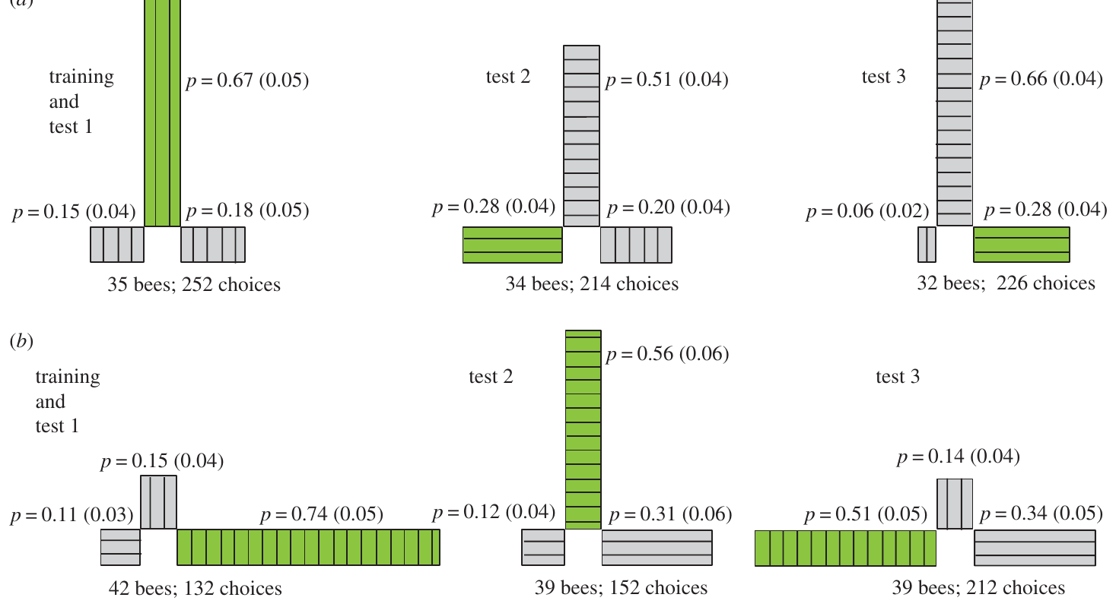
Route choices combine polarization with learned turns
In Kraft and colleagues’ straight-ahead training condition, bees chose the rewarded tunnel on 67% of tests with the original illumination arrangement. Moving the rewarded polarization to the left exit raised left choices from 15% to 28%, but straight-ahead choices remained at 51%.
In the right-turn training condition, bees chose the rewarded right exit on 74% of tests. When its polarization was moved to the straight-ahead exit, straight-ahead choices reached 56%. Three exits gave a random-choice level of approximately 33%.
The cue relocation changed behavior, but it did not erase the learned route preference uniformly across training conditions. Polarization and motor-route memory can both influence choice. The experiment supports learned use of relative e-vector information without claiming that this cue exclusively determines every route decision.
Kraft et al. (2011), Fig. 3a,b. Choices after relocating the rewarded polarization.
Kraft et al. (2011)
23
Notes:
• In Kraft and colleagues’ straight-ahead training condition, bees chose the rewarded tunnel on 67% of tests with the original illumination arrangement. Moving the rewarded polarization to the left exit raised left choices from 15% to 28%, but straight-ahead choices remained at 51%.
– The two training conditions are separate preparations. Their different transfer patterns argue against treating all choices as a pure readout of one sensory cue.
• In the right-turn training condition, bees chose the rewarded right exit on 74% of tests. When its polarization was moved to the straight-ahead exit, straight-ahead choices reached 56%. Three exits gave a random-choice level of approximately 33%.
• The cue relocation changed behavior, but it did not erase the learned route preference uniformly across training conditions. Polarization and motor-route memory can both influence choice. The experiment supports learned use of relative e-vector information without claiming that this cue exclusively determines every route decision.
References:
Kraft P, Evangelista C, Dacke M, Labhart T, Srinivasan MV (2011). Honeybee navigation: following routes using polarized-light cues. Philosophical Transactions of the Royal Society B: Biological Sciences 366(1565): 703-708. https://doi.org/10.1098/rstb.2010.0203
Figure: Kraft et al. (2011), Fig. 3a,b. Choices after relocating the rewarded polarization.
Figure source: https://doi.org/10.1098/rstb.2010.0203

Slide 24
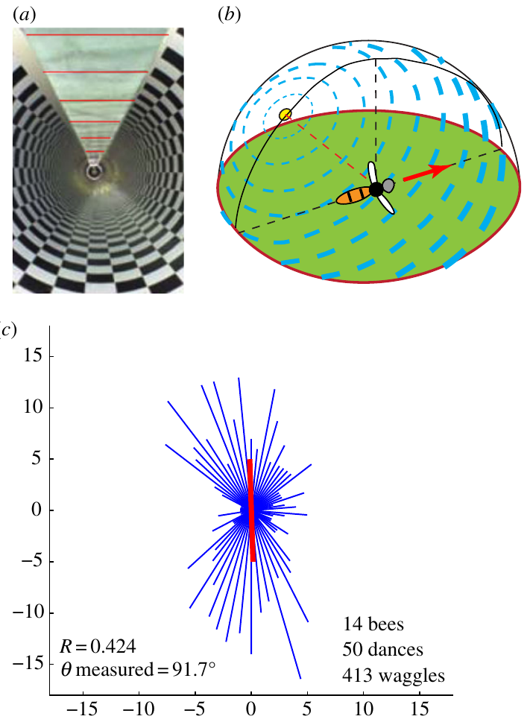
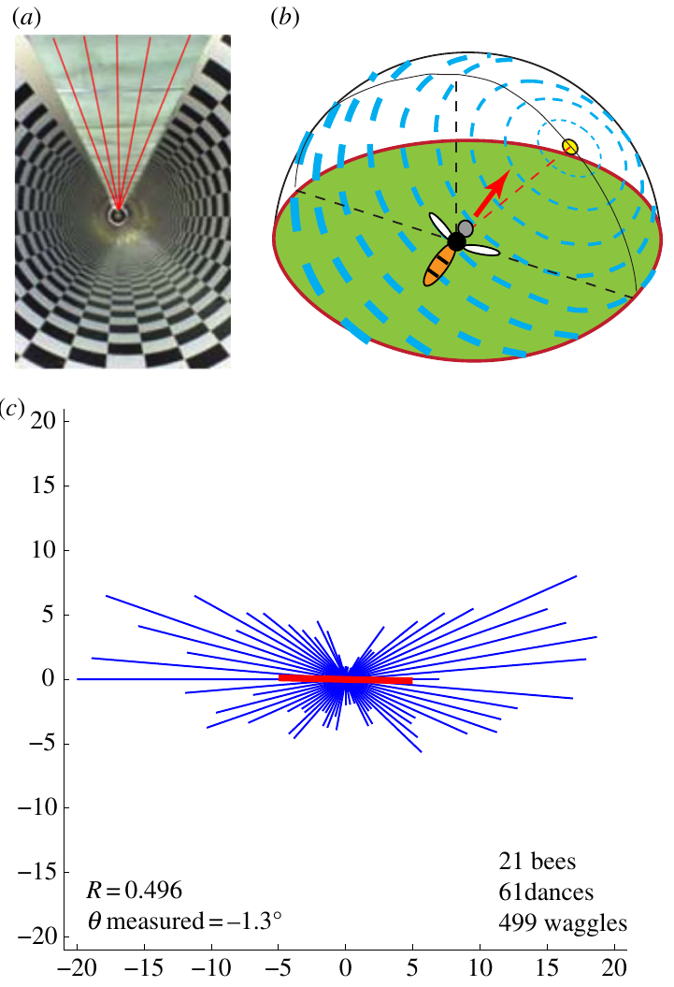
Polarization orientation changes the direction danced
Evangelista and colleagues trained bees through a 12 m textured tunnel covered by ultraviolet-transmitting polarizers and a diffuser. The diffuser removed a direct view of the sun and overhead landmarks, leaving the artificial polarization pattern as the celestial cue.
With transverse polarization, waggle runs clustered along a vertical axis on the comb. With axial polarization, they clustered along a horizontal axis. The reported mean axes were approximately 91.7° and 1.3° relative to horizontal, respectively.
Evangelista et al. (2014), Fig. 2a–c. Transverse polarization and vertical dance runs.
A single e-vector has a 180° ambiguity: the same axis can represent opposite travel directions. Bees advertised both alternatives rather than a unique direction. The experiment links polarized flight input to the communicated direction while distinguishing an axis of possible headings from a fully disambiguated sun-referenced bearing.
Evangelista et al. (2014), Fig. 3a–c. Axial polarization and horizontal dance runs.
Evangelista et al. (2014)
24
Notes:
• Evangelista and colleagues trained bees through a 12 m textured tunnel covered by ultraviolet-transmitting polarizers and a diffuser. The diffuser removed a direct view of the sun and overhead landmarks, leaving the artificial polarization pattern as the celestial cue.
– The polarizer orientation changed while tunnel direction remained fixed. The original article contains the preparation images and measured dance distributions; no direction plots have been reconstructed.
• With transverse polarization, waggle runs clustered along a vertical axis on the comb. With axial polarization, they clustered along a horizontal axis. The reported mean axes were approximately 91.7° and 1.3° relative to horizontal, respectively.
• A single e-vector has a 180° ambiguity: the same axis can represent opposite travel directions. Bees advertised both alternatives rather than a unique direction. The experiment links polarized flight input to the communicated direction while distinguishing an axis of possible headings from a fully disambiguated sun-referenced bearing.
References:
Evangelista C, Kraft P, Dacke M, Labhart T, Srinivasan MV (2014). Honeybee navigation: critically examining the role of the polarization compass. Philosophical Transactions of the Royal Society B: Biological Sciences 369(1636): 20130037. https://doi.org/10.1098/rstb.2013.0037
Figure: Evangelista et al. (2014), Fig. 2a–c. Transverse polarization and vertical dance runs.
Figure source: https://doi.org/10.1098/rstb.2013.0037
Figure: Evangelista et al. (2014), Fig. 3a–c. Axial polarization and horizontal dance runs.
Figure source: https://doi.org/10.1098/rstb.2013.0037

Slide 25
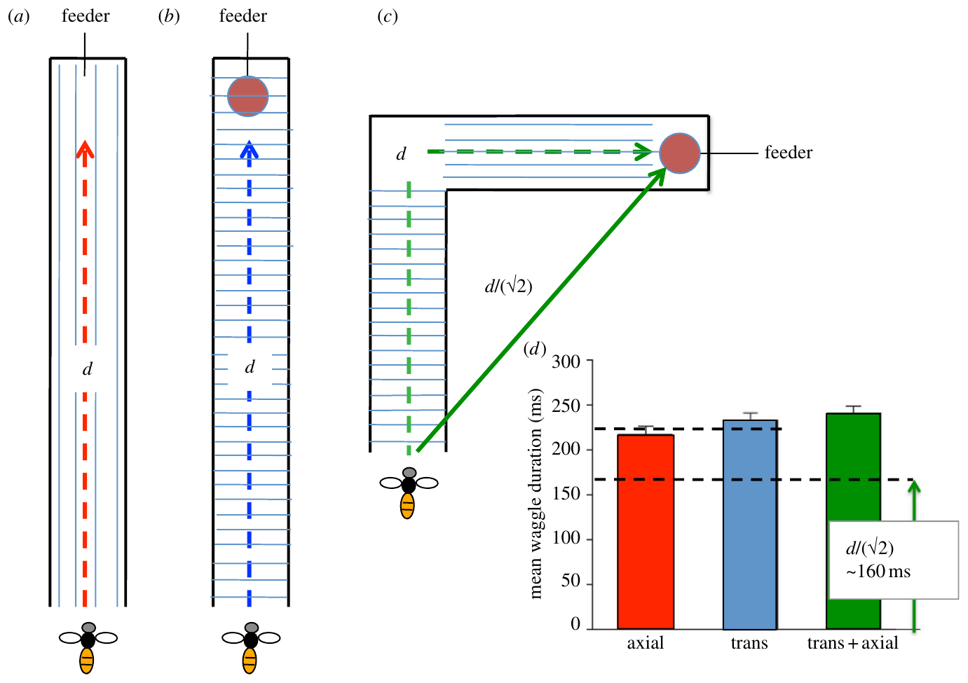
A polarization switch changes the communicated journey
Evangelista and colleagues also changed the polarization axis halfway along the tunnel. The first 6 m and the second 6 m provided perpendicular e-vector orientations, although the physical tunnel itself remained straight.
After the two-segment journey, bees advertised diagonal directions consistent with interpreting a turn between the segments. Their mean waggle duration was shorter than after a tunnel with one uniform polarization axis. The authors related this reduced distance signal to an inferred two-leg displacement.
The intervention alters the sensory compass instruction without inserting an actual corner. It supports combination of directional input with a distance estimate when generating the dance. The inferred trajectory depends on ambiguity in the artificial sky cue, and the study did not directly record neural vector accumulation or identify a central-complex calculation.
Evangelista et al. (2014), Fig. 8. Distance signals after switching polarization mid-route.
Evangelista et al. (2014)
25
Notes:
• Evangelista and colleagues also changed the polarization axis halfway along the tunnel. The first 6 m and the second 6 m provided perpendicular e-vector orientations, although the physical tunnel itself remained straight.
– The source figure includes the authors’ stimulus arrangement and measured durations. The suggested two-leg geometry is an interpretation of the behavior, not a directly observed physical turn.
• After the two-segment journey, bees advertised diagonal directions consistent with interpreting a turn between the segments. Their mean waggle duration was shorter than after a tunnel with one uniform polarization axis. The authors related this reduced distance signal to an inferred two-leg displacement.
• The intervention alters the sensory compass instruction without inserting an actual corner. It supports combination of directional input with a distance estimate when generating the dance. The inferred trajectory depends on ambiguity in the artificial sky cue, and the study did not directly record neural vector accumulation or identify a central-complex calculation.
References:
Evangelista C, Kraft P, Dacke M, Labhart T, Srinivasan MV (2014). Honeybee navigation: critically examining the role of the polarization compass. Philosophical Transactions of the Royal Society B: Biological Sciences 369(1636): 20130037. https://doi.org/10.1098/rstb.2013.0037
Figure: Evangelista et al. (2014), Fig. 8. Distance signals after switching polarization mid-route.
Figure source: https://doi.org/10.1098/rstb.2013.0037

Slide 26
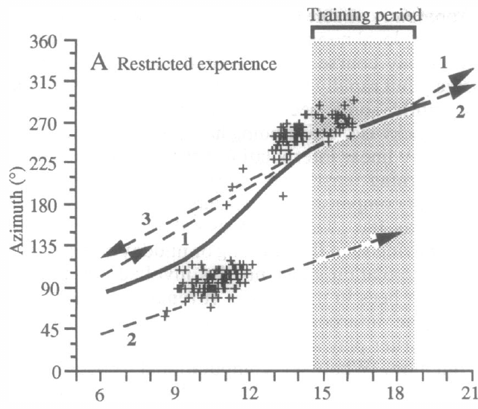
Partial solar experience supports a coarse compass
Solar azimuth is the sun’s horizontal bearing; an ephemeris describes its changing position over the day. Dyer and Dickinson reared bees in an incubator and allowed them to fly outside only during the late afternoon.
On a cloudy test day, these bees flew for the first time during morning and early afternoon. Their dances indicated a morning solar estimate approximately 180° from the evening azimuth they had previously experienced. Around local noon, they switched toward the familiar evening direction.
The bees therefore supplied an approximate morning reference without having directly experienced that portion of the sun’s course. The step-like pattern supports a general expectation of daily solar movement refined by experience. It differs from exact memorization of every hourly sun position and leaves the implementing neuronal computation unresolved.
Dyer & Dickinson (1994), Fig. 2A. Solar estimates after afternoon-only experience.
Dyer & Dickinson (1994)
26
Notes:
• Solar azimuth is the sun’s horizontal bearing; an ephemeris describes its changing position over the day. Dyer and Dickinson reared bees in an incubator and allowed them to fly outside only during the late afternoon.
– Cloud cover removed direct celestial information during the test. Direction was inferred from dances relative to a known food route, not from an electrode measurement of a sun representation.
• On a cloudy test day, these bees flew for the first time during morning and early afternoon. Their dances indicated a morning solar estimate approximately 180° from the evening azimuth they had previously experienced. Around local noon, they switched toward the familiar evening direction.
• The bees therefore supplied an approximate morning reference without having directly experienced that portion of the sun’s course. The step-like pattern supports a general expectation of daily solar movement refined by experience. It differs from exact memorization of every hourly sun position and leaves the implementing neuronal computation unresolved.
References:
Dyer FC, Dickinson JA (1994). Development of sun compensation by honeybees: how partially experienced bees estimate the sun's course. Proceedings of the National Academy of Sciences 91(10): 4471-4474. https://doi.org/10.1073/pnas.91.10.4471
Figure: Dyer & Dickinson (1994), Fig. 2A. Solar estimates after afternoon-only experience.
Figure source: https://doi.org/10.1073/pnas.91.10.4471

Slide 27
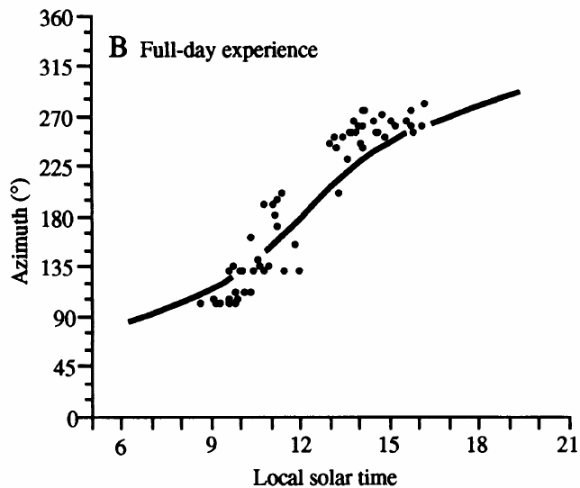
Full-day experience refines the learned solar course
Dyer and Dickinson compared experience-restricted bees with bees that had previously flown throughout the day. Both groups were tested under a cloudy sky, so current direct sight of the sun could not explain the difference in their dance orientations.
Fully experienced bees’ solar estimates followed the continuously changing local sun course more closely. Bees with afternoon-only experience instead used the coarse morning–afternoon pattern. The comparison separates a broad expectation about solar movement from its more precise local calibration.
The sun’s horizontal bearing changes at a variable rate with time, latitude and season; a universal constant angular-rate correction is insufficient. Experience improves the temporal reference used for navigation. The design supports learned calibration but does not isolate whether particular visual scenes, flight directions or training times supplied each component of that learning.
Dyer & Dickinson (1994), Fig. 2B. Experienced bees track the sun under cloud cover.
Dyer & Dickinson (1994)
27
Notes:
• Dyer and Dickinson compared experience-restricted bees with bees that had previously flown throughout the day. Both groups were tested under a cloudy sky, so current direct sight of the sun could not explain the difference in their dance orientations.
– The actual daily course was known independently from astronomical position. Shared cloud cover controls the availability of immediate celestial cues across the two experience conditions.
• Fully experienced bees’ solar estimates followed the continuously changing local sun course more closely. Bees with afternoon-only experience instead used the coarse morning–afternoon pattern. The comparison separates a broad expectation about solar movement from its more precise local calibration.
• The sun’s horizontal bearing changes at a variable rate with time, latitude and season; a universal constant angular-rate correction is insufficient. Experience improves the temporal reference used for navigation. The design supports learned calibration but does not isolate whether particular visual scenes, flight directions or training times supplied each component of that learning.
References:
Dyer FC, Dickinson JA (1994). Development of sun compensation by honeybees: how partially experienced bees estimate the sun's course. Proceedings of the National Academy of Sciences 91(10): 4471-4474. https://doi.org/10.1073/pnas.91.10.4471
Figure: Dyer & Dickinson (1994), Fig. 2B. Experienced bees track the sun under cloud cover.
Figure source: https://doi.org/10.1073/pnas.91.10.4471

Slide 28
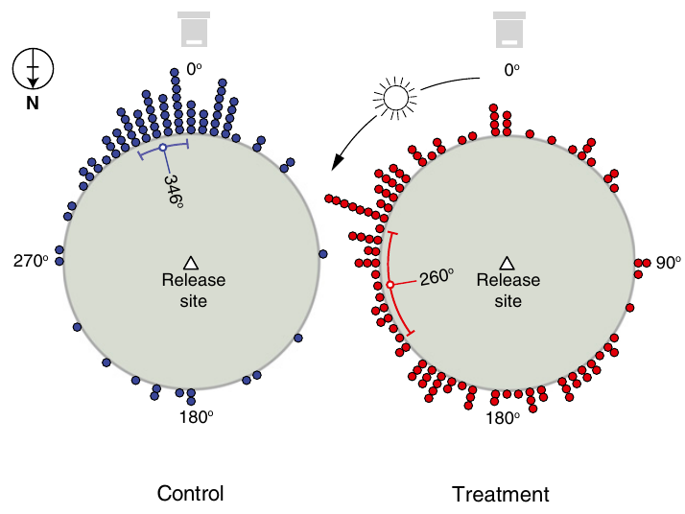
Clock disruption shifts sun-compass flight bearings
A circadian clock is an internal timing system with an approximately daily cycle. Cheeseman and colleagues used 2% isoflurane anesthesia to perturb this timing system and tested subsequent sun-compass homing.
In the Southern Hemisphere, bees trained to a feeder 100 m from the hive were transported 6 km into unfamiliar terrain. Six-hour anesthesia produced an approximately 87° anticlockwise shift in vanishing bearing relative to a 30-min anesthetic control. A vanishing bearing is the direction at which a departing bee leaves the observer’s view.
A time error predicts a directional error because solar bearing depends on time of day. The shifted orientation supports this relationship, but extended anesthesia can also affect general performance. The short-anesthetic control and independent clock measurements are needed to distinguish a timing disturbance from nonspecific drug effects.
Cheeseman et al. (2012), Fig. 1. Anesthesia shifts Southern Hemisphere bearings.
Cheeseman et al. (2012)
28
Notes:
• A circadian clock is an internal timing system with an approximately daily cycle. Cheeseman and colleagues used 2% isoflurane anesthesia to perturb this timing system and tested subsequent sun-compass homing.
– The comparison was between long and short anesthesia, rather than between treatment and an unhandled animal alone. Vanishing bearing samples initial orientation and does not establish eventual homing success.
• In the Southern Hemisphere, bees trained to a feeder 100 m from the hive were transported 6 km into unfamiliar terrain. Six-hour anesthesia produced an approximately 87° anticlockwise shift in vanishing bearing relative to a 30-min anesthetic control. A vanishing bearing is the direction at which a departing bee leaves the observer’s view.
• A time error predicts a directional error because solar bearing depends on time of day. The shifted orientation supports this relationship, but extended anesthesia can also affect general performance. The short-anesthetic control and independent clock measurements are needed to distinguish a timing disturbance from nonspecific drug effects.
References:
Cheeseman JF, Winnebeck EC, Millar CD, Kirkland LS, Sleigh J, Goodwin M, Pawley MDM, Bloch G, Lehmann K, Menzel R, Warman GR (2012). General anesthesia alters time perception by phase shifting the circadian clock. Proceedings of the National Academy of Sciences 109(18): 7061-7066. https://doi.org/10.1073/pnas.1201734109
Figure: Cheeseman et al. (2012), Fig. 1. Anesthesia shifts Southern Hemisphere bearings.
Figure source: https://doi.org/10.1073/pnas.1201734109

Slide 29
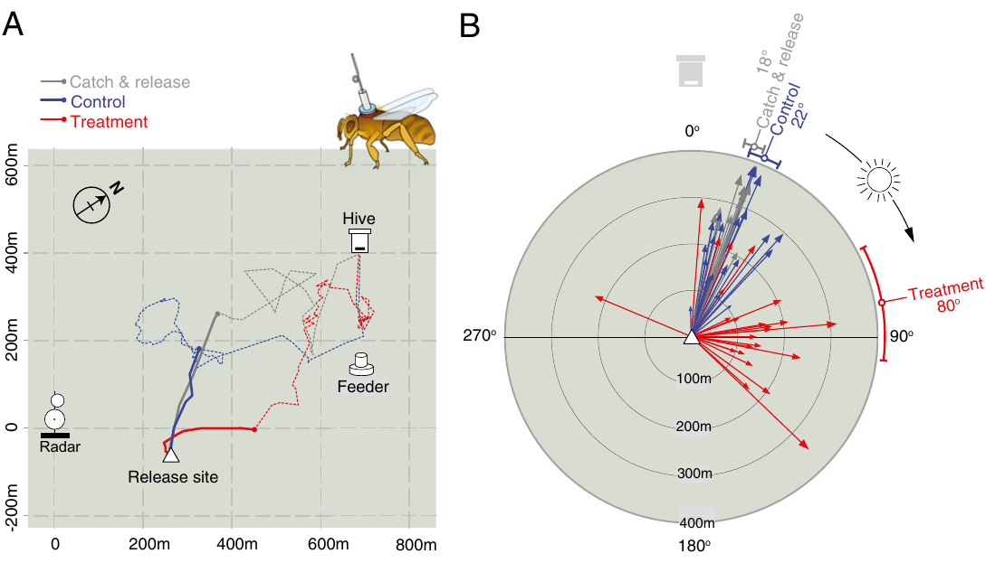
The opposite hemisphere reverses the directional error
Cheeseman and colleagues repeated the navigation test in the Northern Hemisphere using harmonic radar. Bees trained to a feeder 300 m from the hive were displaced 500 m before release, allowing the initial homeward vector flight to be separated from later correction.
Six-hour anesthesia shifted the initial vector approximately 58° clockwise relative to the 30-min control. Unanesthetized catch-and-release bees provided another handling comparison. The direction of the error was opposite to the Southern Hemisphere result, as expected from the different solar course.
The hemisphere comparison links the behavioral error to sun-compass timing rather than to a fixed tendency to turn left or right after treatment. Individual variation and possible secondary cues remain. The measured trajectory establishes an altered initial compass instruction, without locating its neural implementation.
Cheeseman et al. (2012), Fig. 2A,B. Northern Hemisphere tracks after clock disruption.
Cheeseman et al. (2012)
29
Notes:
• Cheeseman and colleagues repeated the navigation test in the Northern Hemisphere using harmonic radar. Bees trained to a feeder 300 m from the hive were displaced 500 m before release, allowing the initial homeward vector flight to be separated from later correction.
– A compass error tied to solar movement can reverse sign across hemispheres. A fixed lateral motor bias would not predict that reversal.
• Six-hour anesthesia shifted the initial vector approximately 58° clockwise relative to the 30-min control. Unanesthetized catch-and-release bees provided another handling comparison. The direction of the error was opposite to the Southern Hemisphere result, as expected from the different solar course.
• The hemisphere comparison links the behavioral error to sun-compass timing rather than to a fixed tendency to turn left or right after treatment. Individual variation and possible secondary cues remain. The measured trajectory establishes an altered initial compass instruction, without locating its neural implementation.
References:
Cheeseman JF, Winnebeck EC, Millar CD, Kirkland LS, Sleigh J, Goodwin M, Pawley MDM, Bloch G, Lehmann K, Menzel R, Warman GR (2012). General anesthesia alters time perception by phase shifting the circadian clock. Proceedings of the National Academy of Sciences 109(18): 7061-7066. https://doi.org/10.1073/pnas.1201734109
Figure: Cheeseman et al. (2012), Fig. 2A,B. Northern Hemisphere tracks after clock disruption.
Figure source: https://doi.org/10.1073/pnas.1201734109

Slide 30
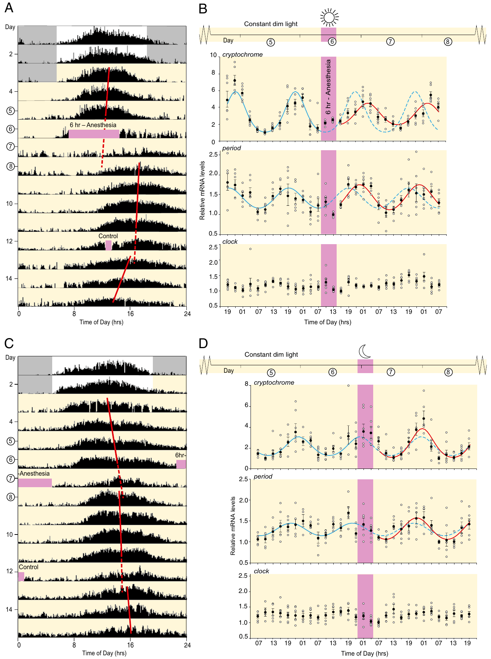
Anesthesia changes molecular-clock phase
Cheeseman and colleagues measured hive activity under constant dim light, removing ordinary day–night transitions as the immediate cause of a shifted rhythm. Daytime six-hour anesthesia delayed daily activity and altered rhythmic gene expression in sampled bee brains.
The reported phase delays were 4.9 h for mammalian-type cryptochrome messenger RNA and 4.3 h for period messenger RNA. Messenger RNA is the transcript used to produce a gene’s protein. The sampled hive’s activity phase shifted by 5.3 h, while clock expression remained broadly constitutive.
Six-hour anesthesia during subjective night did not produce the same delay. This time-dependent effect supports disturbance of the circadian oscillator rather than a literal six-hour pause in all behavior. Whole-brain expression cannot specify the cells delivering time information to a compass pathway or identify the relevant anesthetic receptor.
Cheeseman et al. (2012), Fig. 4A–D. Activity rhythms and clock-gene expression.
Cheeseman et al. (2012)
30
Notes:
• Cheeseman and colleagues measured hive activity under constant dim light, removing ordinary day–night transitions as the immediate cause of a shifted rhythm. Daytime six-hour anesthesia delayed daily activity and altered rhythmic gene expression in sampled bee brains.
– Cryptochrome and period expression were sampled across the daily cycle rather than at a single post-treatment time. A phase shift changes when the rhythm peaks, not simply whether a gene is expressed.
• The reported phase delays were 4.9 h for mammalian-type cryptochrome messenger RNA and 4.3 h for period messenger RNA. Messenger RNA is the transcript used to produce a gene’s protein. The sampled hive’s activity phase shifted by 5.3 h, while clock expression remained broadly constitutive.
• Six-hour anesthesia during subjective night did not produce the same delay. This time-dependent effect supports disturbance of the circadian oscillator rather than a literal six-hour pause in all behavior. Whole-brain expression cannot specify the cells delivering time information to a compass pathway or identify the relevant anesthetic receptor.
References:
Cheeseman JF, Winnebeck EC, Millar CD, Kirkland LS, Sleigh J, Goodwin M, Pawley MDM, Bloch G, Lehmann K, Menzel R, Warman GR (2012). General anesthesia alters time perception by phase shifting the circadian clock. Proceedings of the National Academy of Sciences 109(18): 7061-7066. https://doi.org/10.1073/pnas.1201734109
Figure: Cheeseman et al. (2012), Fig. 4A–D. Activity rhythms and clock-gene expression.
Figure source: https://doi.org/10.1073/pnas.1201734109

Slide 31
Dorsal-rim afferents reach a specialized medulla region
Zeller and colleagues injected fluorescent tracers into the dorsal rim of the honeybee eye and labeled surrounding neuropil. Neuropil is tissue containing interwoven neuronal branches and synapses. The medulla is a visual-processing region within the optic lobe.
Dorsal-rim input reached a distinct dorsal-medulla compartment called the MEDRA. Complementary injections into other pathway regions and synapsin labeling distinguished this compartment from neighboring medulla. The published micrographs preserve anatomical orientation and micrometer scale bars.
This tracing identifies an entry pathway for polarization-associated visual input. It does not by itself measure e-vector tuning or prove that every labeled connection is required for dance orientation. Anatomical localization and Sakura’s regional-occlusion experiment address different links between sensory specialization and behavior.
Zeller et al. (2015), Fig. 1A–F. Dorsal-rim input reaches dorsal medulla.
Zeller et al. (2015); Sakura et al. (2012)
31
Notes:
• Zeller and colleagues injected fluorescent tracers into the dorsal rim of the honeybee eye and labeled surrounding neuropil. Neuropil is tissue containing interwoven neuronal branches and synapses. The medulla is a visual-processing region within the optic lobe.
– Afferents are neurons carrying input into a processing region. Tracer transport identifies projection geometry, while synapsin staining supplies a reference for the surrounding synaptic tissue.
• Dorsal-rim input reached a distinct dorsal-medulla compartment called the MEDRA. Complementary injections into other pathway regions and synapsin labeling distinguished this compartment from neighboring medulla. The published micrographs preserve anatomical orientation and micrometer scale bars.
• This tracing identifies an entry pathway for polarization-associated visual input. It does not by itself measure e-vector tuning or prove that every labeled connection is required for dance orientation. Anatomical localization and Sakura’s regional-occlusion experiment address different links between sensory specialization and behavior.
References:
Zeller M, Held M, Bender J, Berz A, Heinloth T, Hellfritz T, Pfeiffer K (2015). Transmedulla Neurons in the Sky Compass Network of the Honeybee (Apis mellifera) Are a Possible Site of Circadian Input. PLOS ONE 10(12): e0143244. https://doi.org/10.1371/journal.pone.0143244
Sakura M, Okada R, Aonuma H (2012). Evidence for instantaneous e-vector detection in the honeybee using an associative learning paradigm. Proceedings of the Royal Society B: Biological Sciences 279(1728): 535-542. https://doi.org/10.1098/rspb.2011.0929
Figure: Zeller et al. (2015), Fig. 1A–F. Dorsal-rim input reaches dorsal medulla.
Figure source: https://doi.org/10.1371/journal.pone.0143244

Slide 32
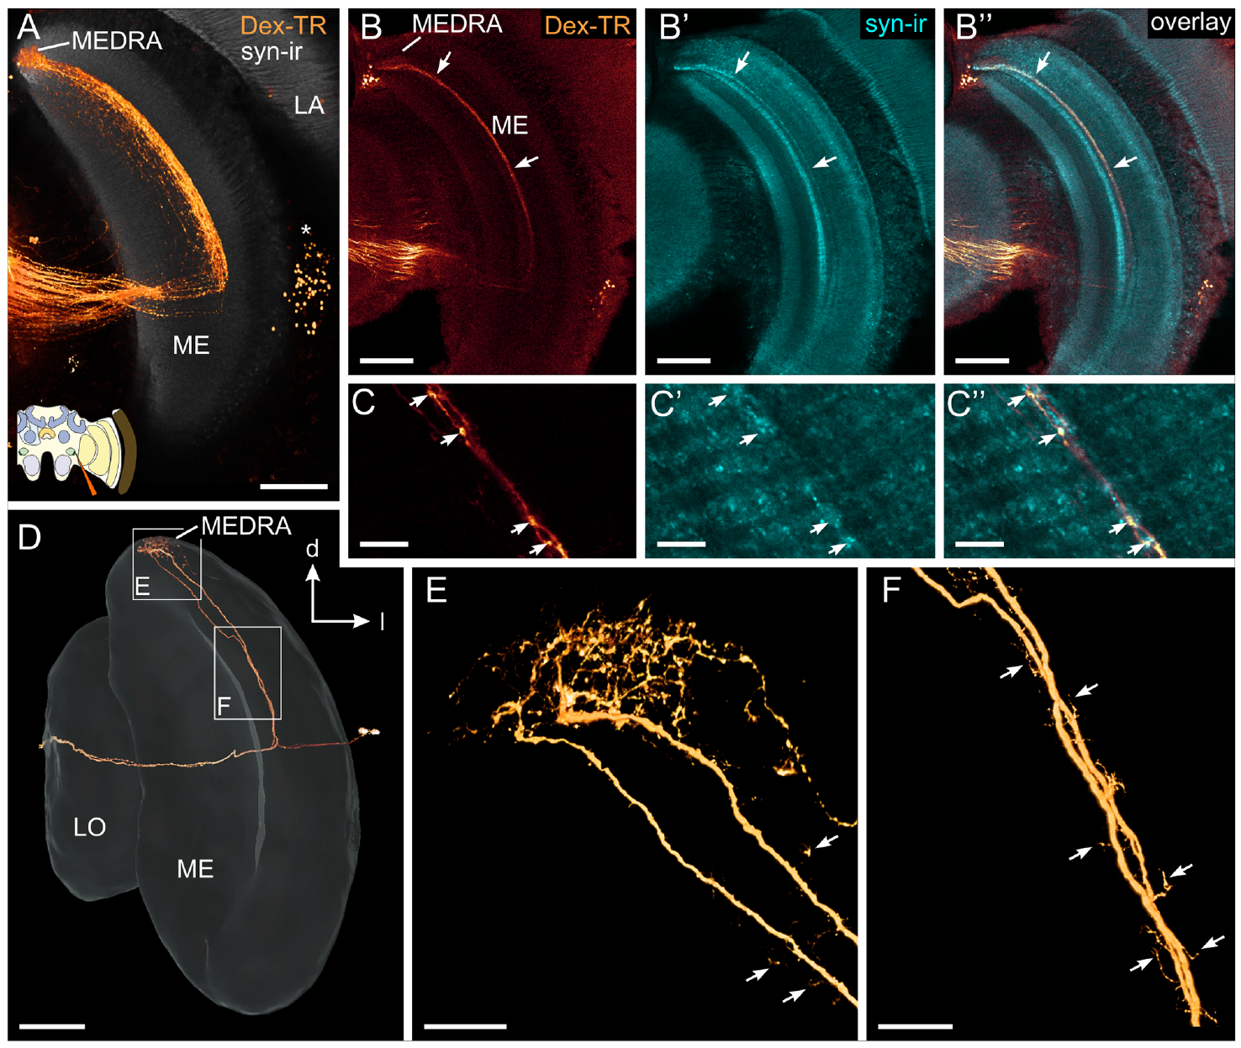
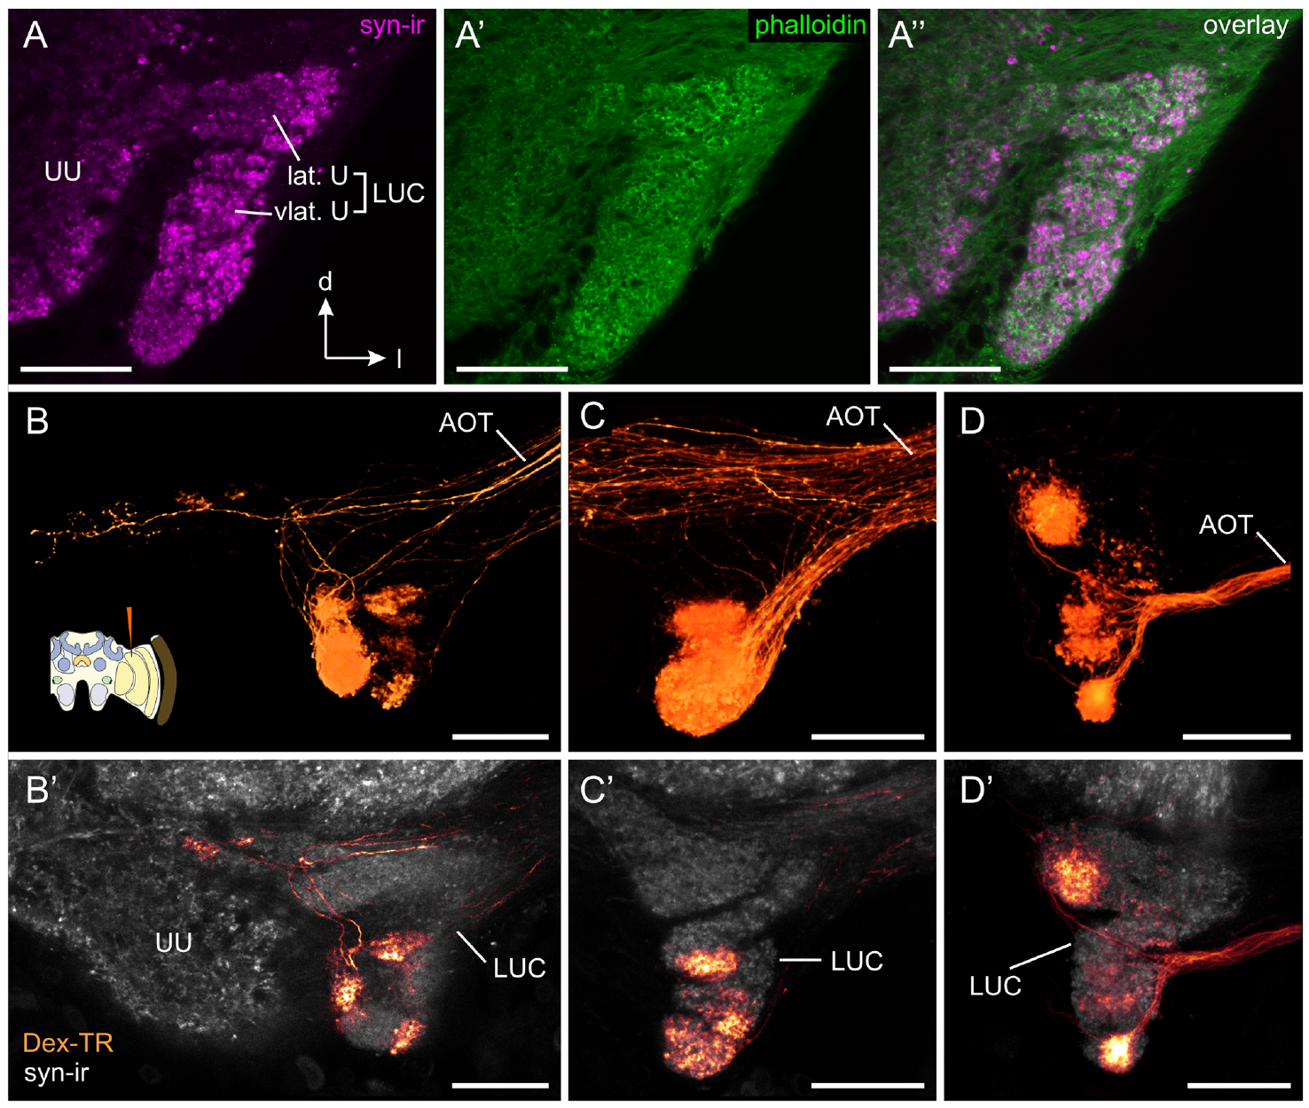
Transmedulla neurons relay dorsal visual input medially
Zeller and colleagues traced transmedulla neurons, cells whose branches cross the medulla from the dorsal-rim-associated input compartment toward more medial brain regions. Dye injections from different locations provided complementary views of their branching pattern.
These neurons arborized in the MEDRA and extended through a defined medulla layer. Their medial projections reached the lower-unit complex of the anterior optic tubercle, a visual-processing center outside the optic lobe. Fine terminal morphology distinguished plausible input and output portions of the pathway.
Zeller et al. (2015), Fig. 2A–F. Transmedulla neuron branches and medial projections.
The ordered projection provides an anatomical route from specialized eye input toward central compass circuitry. Morphology supports this direction of information flow but cannot replace physiological measurements of transmission. The study did not identify a transmitter for every transmedulla cell or directly establish its role in correcting a dance angle for time of day.
Zeller et al. (2015), Fig. 3A–D. Projections to the lower anterior optic tubercle.
Zeller et al. (2015)
32
Notes:
• Zeller and colleagues traced transmedulla neurons, cells whose branches cross the medulla from the dorsal-rim-associated input compartment toward more medial brain regions. Dye injections from different locations provided complementary views of their branching pattern.
– The anterior optic tubercle is divided into compartments. The lower-unit complex is associated with this traced pathway, so the term does not refer to every tubercle neuron indiscriminately.
• These neurons arborized in the MEDRA and extended through a defined medulla layer. Their medial projections reached the lower-unit complex of the anterior optic tubercle, a visual-processing center outside the optic lobe. Fine terminal morphology distinguished plausible input and output portions of the pathway.
• The ordered projection provides an anatomical route from specialized eye input toward central compass circuitry. Morphology supports this direction of information flow but cannot replace physiological measurements of transmission. The study did not identify a transmitter for every transmedulla cell or directly establish its role in correcting a dance angle for time of day.
References:
Zeller M, Held M, Bender J, Berz A, Heinloth T, Hellfritz T, Pfeiffer K (2015). Transmedulla Neurons in the Sky Compass Network of the Honeybee (Apis mellifera) Are a Possible Site of Circadian Input. PLOS ONE 10(12): e0143244. https://doi.org/10.1371/journal.pone.0143244
Figure: Zeller et al. (2015), Fig. 2A–F. Transmedulla neuron branches and medial projections.
Figure source: https://doi.org/10.1371/journal.pone.0143244
Figure: Zeller et al. (2015), Fig. 3A–D. Projections to the lower anterior optic tubercle.
Figure source: https://doi.org/10.1371/journal.pone.0143244

Slide 33
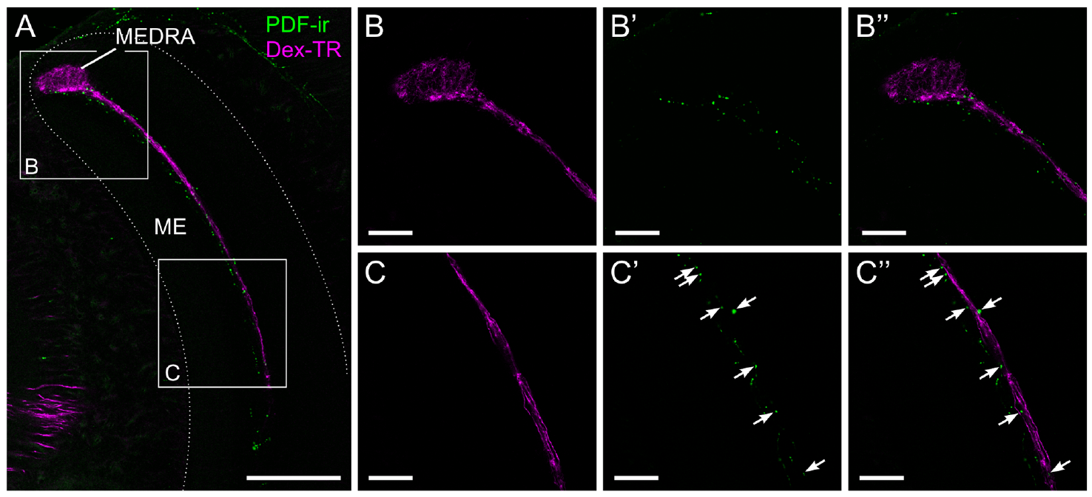
PDF-positive fibers are candidate timing inputs
Pigment-dispersing factor, or PDF, is a neuropeptide associated with circadian signaling in insects. Zeller and colleagues combined PDF immunostaining with tracer labeling of transmedulla neurons to ask where potential timing input could meet the honeybee sky-compass pathway.
PDF-positive fibers occupied the same medulla layer as parts of the traced neurons. At higher magnification, labeled puncta lay in close proximity along their passage through the medulla. The two labels did not colocalize, and PDF labeling was not found within the MEDRA itself.
Zeller et al. (2015), Fig. 5A–C. PDF-positive fibers lie beside transmedulla neurons.
The result identifies neighboring neuronal populations and a candidate site for modulation. Close proximity does not establish peptide release, a postsynaptic PDF receptor or a functional synapse. Circadian compass correction is therefore a proposed role of this contact region rather than a demonstrated action of PDF on these neurons.
Zeller et al. (2015)
33
Notes:
• Pigment-dispersing factor, or PDF, is a neuropeptide associated with circadian signaling in insects. Zeller and colleagues combined PDF immunostaining with tracer labeling of transmedulla neurons to ask where potential timing input could meet the honeybee sky-compass pathway.
– Immunoreactivity means that an antibody recognizes a target in the preparation. It supports the presence of the labeled substance, but a nearby labeled bouton is not equivalent to a confirmed connection.
• PDF-positive fibers occupied the same medulla layer as parts of the traced neurons. At higher magnification, labeled puncta lay in close proximity along their passage through the medulla. The two labels did not colocalize, and PDF labeling was not found within the MEDRA itself.
• The result identifies neighboring neuronal populations and a candidate site for modulation. Close proximity does not establish peptide release, a postsynaptic PDF receptor or a functional synapse. Circadian compass correction is therefore a proposed role of this contact region rather than a demonstrated action of PDF on these neurons.
References:
Zeller M, Held M, Bender J, Berz A, Heinloth T, Hellfritz T, Pfeiffer K (2015). Transmedulla Neurons in the Sky Compass Network of the Honeybee (Apis mellifera) Are a Possible Site of Circadian Input. PLOS ONE 10(12): e0143244. https://doi.org/10.1371/journal.pone.0143244
Figure: Zeller et al. (2015), Fig. 5A–C. PDF-positive fibers lie beside transmedulla neurons.
Figure source: https://doi.org/10.1371/journal.pone.0143244

Slide 34
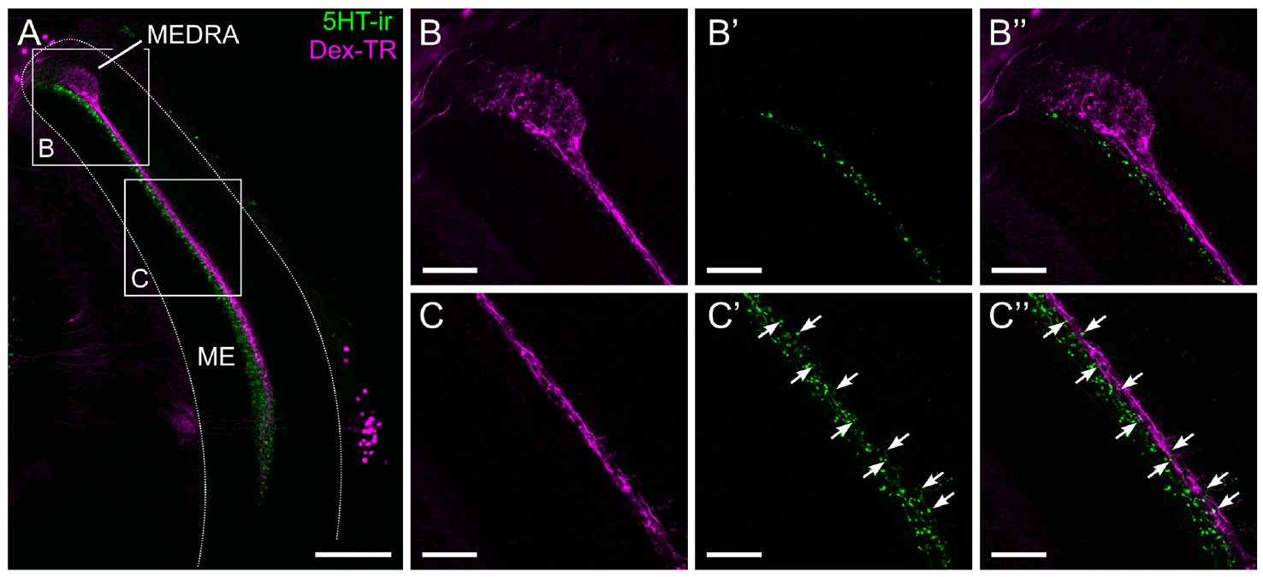
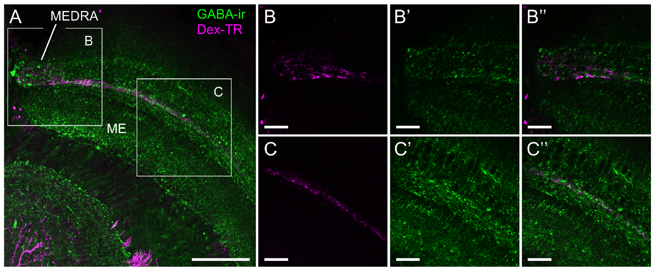
Serotonin and GABA lie near compass-pathway branches
Zeller and colleagues combined transmedulla tracer labeling with antibodies against serotonin, a monoamine signaling molecule, and GABA, gamma-aminobutyric acid. GABA commonly contributes inhibitory signaling, but its action at a particular connection requires receptor and physiological evidence.
Serotonin-positive puncta overlapped the dorsal portion of the relevant medulla layer but not the MEDRA. GABA-positive fibers lay near transmedulla branches throughout their length, including the MEDRA. In both preparations, tracer and transmitter labels marked different populations rather than the same cells.
Zeller et al. (2015), Fig. 6A–C. Serotonin-positive fibers and transmedulla neurons.
These spatial relationships support candidate modulatory and local processing interactions. They do not establish whether serotonin increases or decreases compass-pathway excitability or whether a particular GABA receptor or chloride conductance mediates an effect. The necessary receptor identity, synaptic direction and time-dependent physiology remain unmeasured in this anatomical study.
Zeller et al. (2015), Fig. 7A–C. GABA-positive fibers near compass-pathway cells.
Zeller et al. (2015)
34
Notes:
• Zeller and colleagues combined transmedulla tracer labeling with antibodies against serotonin, a monoamine signaling molecule, and GABA, gamma-aminobutyric acid. GABA commonly contributes inhibitory signaling, but its action at a particular connection requires receptor and physiological evidence.
– Different distributions imply different possible access to the traced pathway. Assigning an excitatory or inhibitory effect solely from proximity would go beyond the experiment.
• Serotonin-positive puncta overlapped the dorsal portion of the relevant medulla layer but not the MEDRA. GABA-positive fibers lay near transmedulla branches throughout their length, including the MEDRA. In both preparations, tracer and transmitter labels marked different populations rather than the same cells.
• These spatial relationships support candidate modulatory and local processing interactions. They do not establish whether serotonin increases or decreases compass-pathway excitability or whether a particular GABA receptor or chloride conductance mediates an effect. The necessary receptor identity, synaptic direction and time-dependent physiology remain unmeasured in this anatomical study.
References:
Zeller M, Held M, Bender J, Berz A, Heinloth T, Hellfritz T, Pfeiffer K (2015). Transmedulla Neurons in the Sky Compass Network of the Honeybee (Apis mellifera) Are a Possible Site of Circadian Input. PLOS ONE 10(12): e0143244. https://doi.org/10.1371/journal.pone.0143244
Figure: Zeller et al. (2015), Fig. 6A–C. Serotonin-positive fibers and transmedulla neurons.
Figure source: https://doi.org/10.1371/journal.pone.0143244
Figure: Zeller et al. (2015), Fig. 7A–C. GABA-positive fibers near compass-pathway cells.
Figure source: https://doi.org/10.1371/journal.pone.0143244

Slide 35
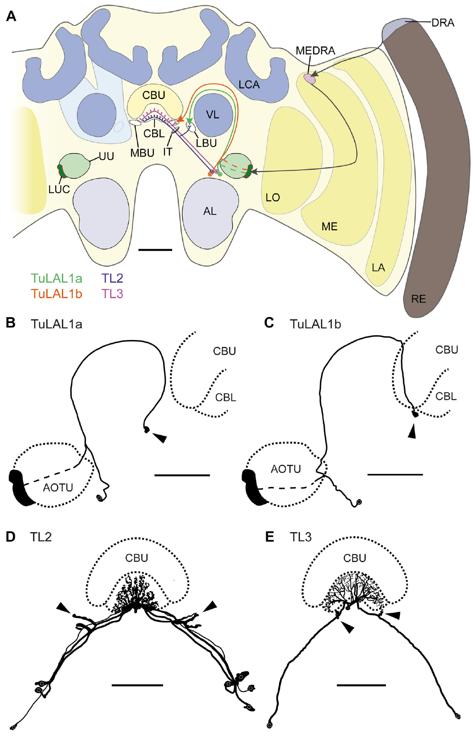
Tubercle outputs reach bulbs and the central body
Held and colleagues traced the honeybee sky-compass network using dye injections, neuropil labeling and single-cell preparations. TuLAL1 neurons project from the anterior optic tubercle toward paired synaptic regions called the lateral and medial bulbs.
A second class, TL neurons, connects these bulbs with the lower division of the central body, part of the central complex. The labeled branches establish two parallel anatomical routes from tubercle outputs toward central-brain circuitry associated with directional processing.
The bulbs provide a defined interface rather than an undifferentiated relay. The study identifies its neurons and terminal organization, but it does not directly record a honeybee heading code or demonstrate the conversion of that code into a waggle-run angle. Functional interpretations must remain separate from the measured projection anatomy.
Held et al. (2016), Fig. 1A–F. AOTU–bulb–central-body projection anatomy.
Held et al. (2016)
35
Notes:
• Held and colleagues traced the honeybee sky-compass network using dye injections, neuropil labeling and single-cell preparations. TuLAL1 neurons project from the anterior optic tubercle toward paired synaptic regions called the lateral and medial bulbs.
– The pathway nomenclature names the projection classes used by the authors. The original article’s anatomical drawing is included unchanged; no circuit has been newly drawn for this deck.
• A second class, TL neurons, connects these bulbs with the lower division of the central body, part of the central complex. The labeled branches establish two parallel anatomical routes from tubercle outputs toward central-brain circuitry associated with directional processing.
• The bulbs provide a defined interface rather than an undifferentiated relay. The study identifies its neurons and terminal organization, but it does not directly record a honeybee heading code or demonstrate the conversion of that code into a waggle-run angle. Functional interpretations must remain separate from the measured projection anatomy.
References:
Held M, Berz A, Hensgen R, Muenz TS, Scholl C, Rössler W, Homberg U, Pfeiffer K (2016). Microglomerular Synaptic Complexes in the Sky-Compass Network of the Honeybee Connect Parallel Pathways from the Anterior Optic Tubercle to the Central Complex. Frontiers in Behavioral Neuroscience 10: 186. https://doi.org/10.3389/fnbeh.2016.00186
Figure: Held et al. (2016), Fig. 1A–F. AOTU–bulb–central-body projection anatomy.
Figure source: https://doi.org/10.3389/fnbeh.2016.00186

Slide 36
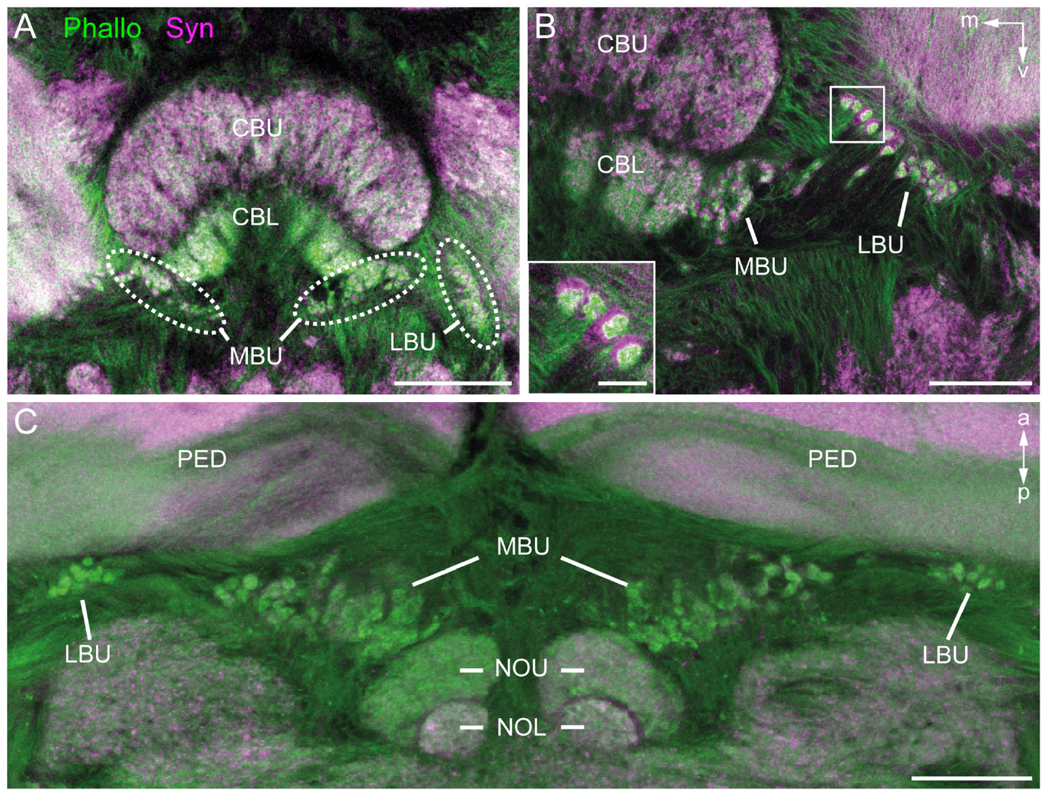
Bulb microglomeruli organize convergent synaptic tissue
A microglomerulus is a compact synaptic complex in which a large presynaptic terminal contacts several smaller postsynaptic processes. Held and colleagues stained honeybee bulb tissue for synapsin, associated with presynaptic machinery, and filamentous actin, prominent in postsynaptic regions.
Confocal images revealed separated microglomerular complexes in the lateral and medial bulbs. Traced TuLAL1 terminals occupied the presynaptic cores, while postsynaptic processes from TL neurons contacted them. Complementary labeling linked cell projections to the local terminal organization.
The stains identify an anatomical arrangement for distributing tubercle signals among downstream neurons. Confocal proximity alone cannot resolve every membrane contact, so the authors also used electron microscopy. These structures are a measured substrate for parallel processing, without establishing what exact directional information each complex carries during flight or dancing.
Held et al. (2016), Fig. 2A–C. Synapsin and actin identify bulb microglomeruli.
Held et al. (2016)
36
Notes:
• A microglomerulus is a compact synaptic complex in which a large presynaptic terminal contacts several smaller postsynaptic processes. Held and colleagues stained honeybee bulb tissue for synapsin, associated with presynaptic machinery, and filamentous actin, prominent in postsynaptic regions.
– Synapsin and actin are markers, not themselves a transmitter identity. Their different distributions help separate terminal compartments before synaptic membrane structure is examined.
• Confocal images revealed separated microglomerular complexes in the lateral and medial bulbs. Traced TuLAL1 terminals occupied the presynaptic cores, while postsynaptic processes from TL neurons contacted them. Complementary labeling linked cell projections to the local terminal organization.
• The stains identify an anatomical arrangement for distributing tubercle signals among downstream neurons. Confocal proximity alone cannot resolve every membrane contact, so the authors also used electron microscopy. These structures are a measured substrate for parallel processing, without establishing what exact directional information each complex carries during flight or dancing.
References:
Held M, Berz A, Hensgen R, Muenz TS, Scholl C, Rössler W, Homberg U, Pfeiffer K (2016). Microglomerular Synaptic Complexes in the Sky-Compass Network of the Honeybee Connect Parallel Pathways from the Anterior Optic Tubercle to the Central Complex. Frontiers in Behavioral Neuroscience 10: 186. https://doi.org/10.3389/fnbeh.2016.00186
Figure: Held et al. (2016), Fig. 2A–C. Synapsin and actin identify bulb microglomeruli.
Figure source: https://doi.org/10.3389/fnbeh.2016.00186

Slide 37
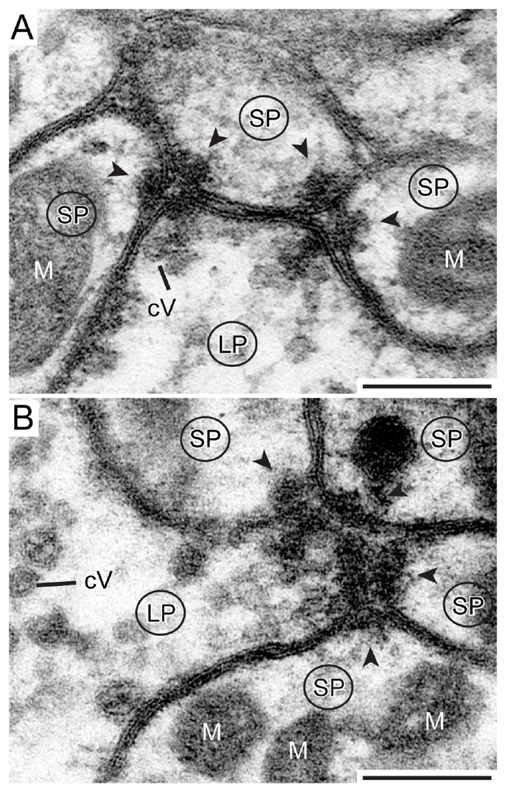
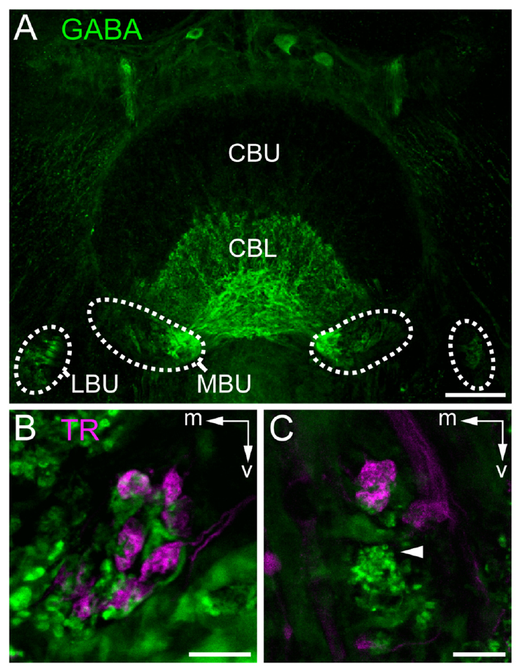
Electron microscopy resolves bulb synaptic contacts
Held and colleagues used transmission electron microscopy to examine honeybee bulb complexes at membrane resolution. Large TuLAL1 terminals contained vesicles and multiple presynaptic specializations facing smaller profiles. Vesicles are membrane-bound structures that store releasable signaling molecules.
The authors identified dyadic and tetradic contacts, where one presynaptic specialization faced two or four postsynaptic profiles. GABA immunostaining associated downstream TL neurons with an inhibitory transmitter phenotype. These observations constrain connectivity more directly than a light-microscopy overlap.
Synaptic morphology establishes physical contacts, and transmitter staining supports a candidate sign of downstream signaling. Neither observation identifies all postsynaptic receptors or the activity-dependent effect on a navigation computation. A GABA-associated projection is not sufficient evidence for a specific chloride-channel mechanism at every terminal in the network.
Held et al. (2016), Fig. 5A–C. GABA-positive tangential-neuron terminals.
Held et al. (2016), Fig. 7A,B. Dyadic and tetradic synapses in bulb complexes.
Held et al. (2016)
37
Notes:
• Held and colleagues used transmission electron microscopy to examine honeybee bulb complexes at membrane resolution. Large TuLAL1 terminals contained vesicles and multiple presynaptic specializations facing smaller profiles. Vesicles are membrane-bound structures that store releasable signaling molecules.
– Dyadic and tetradic count the postsynaptic profiles at a single specialization. They do not imply that the entire presynaptic neuron has only two or four targets.
• The authors identified dyadic and tetradic contacts, where one presynaptic specialization faced two or four postsynaptic profiles. GABA immunostaining associated downstream TL neurons with an inhibitory transmitter phenotype. These observations constrain connectivity more directly than a light-microscopy overlap.
• Synaptic morphology establishes physical contacts, and transmitter staining supports a candidate sign of downstream signaling. Neither observation identifies all postsynaptic receptors or the activity-dependent effect on a navigation computation. A GABA-associated projection is not sufficient evidence for a specific chloride-channel mechanism at every terminal in the network.
References:
Held M, Berz A, Hensgen R, Muenz TS, Scholl C, Rössler W, Homberg U, Pfeiffer K (2016). Microglomerular Synaptic Complexes in the Sky-Compass Network of the Honeybee Connect Parallel Pathways from the Anterior Optic Tubercle to the Central Complex. Frontiers in Behavioral Neuroscience 10: 186. https://doi.org/10.3389/fnbeh.2016.00186
Figure: Held et al. (2016), Fig. 7A,B. Dyadic and tetradic synapses in bulb complexes.
Figure source: https://doi.org/10.3389/fnbeh.2016.00186
Figure: Held et al. (2016), Fig. 5A–C. GABA-positive tangential-neuron terminals.
Figure source: https://doi.org/10.3389/fnbeh.2016.00186

Slide 38
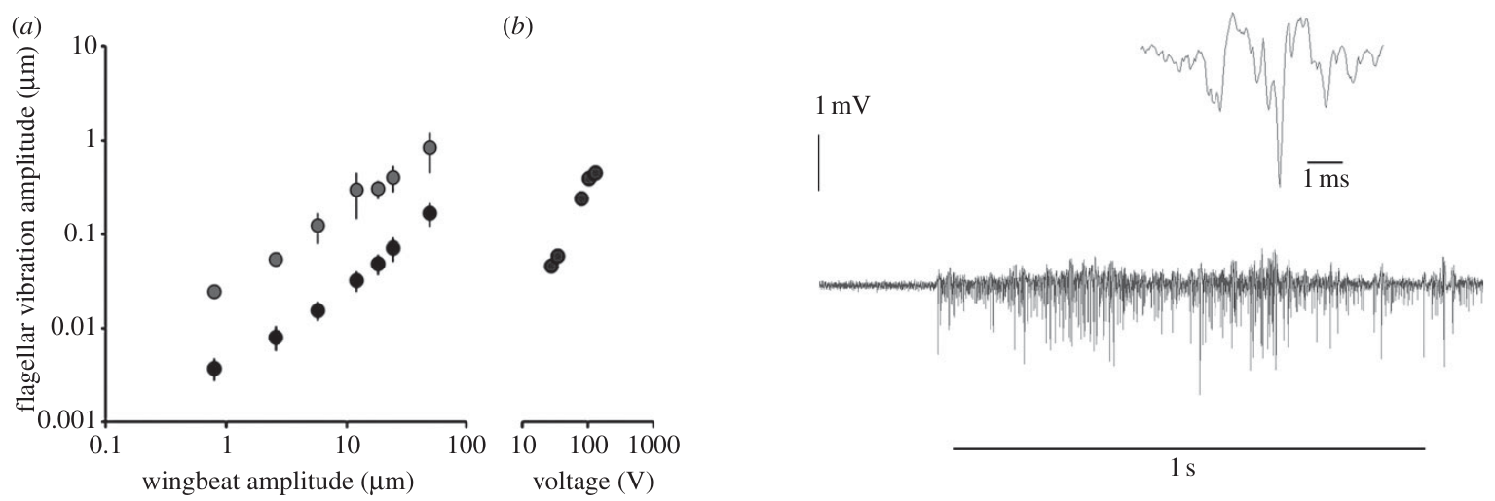
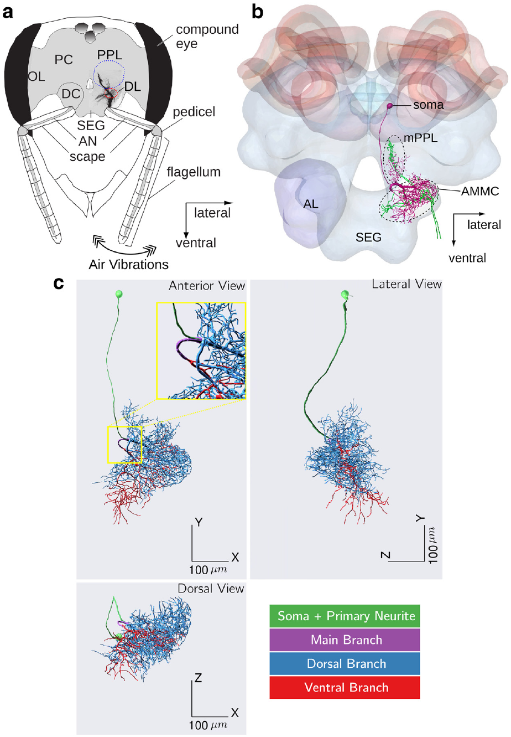
Electric fields can mechanically deflect bee antennae
Greggers and colleagues recorded electric fields around dancing bees and measured antennal movements during controlled electrical stimulation. Charged bodies can exert forces on nearby charged structures; detecting such a force does not require a dedicated electric-field receptor.
An isolated wing oscillating at 40 Hz, 2 mm from the head, evoked larger flagellar movements when charge was preserved rather than discharged. Laser Doppler measurements quantified these movements. Johnston’s organ, a mechanosensory organ in the antennal pedicel, responded to field-induced movement. The flagellum is the distal antennal segment, and the pedicel is its supporting joint region.
Greggers et al. (2013), Fig. 3a,b and Fig. 4. Field-induced flagellar motion and Johnston-organ activity.
The resulting sequence is an electric force, antennal displacement and activation of movement-sensitive sensory neurons. This supports a mechanical route for field detection. It does not establish that electric fields are necessary for natural dance decoding or identify the mechanotransduction channel converting movement into receptor current.
Kumaraswamy et al. (2019), Fig. 1a–c. Antennal input, mechanosensory neuropils and DL-Int-1.
Greggers et al. (2013)
38
Notes:
• Greggers and colleagues recorded electric fields around dancing bees and measured antennal movements during controlled electrical stimulation. Charged bodies can exert forces on nearby charged structures; detecting such a force does not require a dedicated electric-field receptor.
– A moving flagellum can stimulate the same mechanical sensory apparatus through different physical causes. The published anatomical panel locates the organ and the afferent route into the brain.
• An isolated wing oscillating at 40 Hz, 2 mm from the head, evoked larger flagellar movements when charge was preserved rather than discharged. Laser Doppler measurements quantified these movements. Johnston’s organ, a mechanosensory organ in the antennal pedicel, responded to field-induced movement. The flagellum is the distal antennal segment, and the pedicel is its supporting joint region.
• The resulting sequence is an electric force, antennal displacement and activation of movement-sensitive sensory neurons. This supports a mechanical route for field detection. It does not establish that electric fields are necessary for natural dance decoding or identify the mechanotransduction channel converting movement into receptor current.
References:
Greggers U, Koch G, Schmidt V, Dürr A, Floriou-Servou A, Piepenbrock D, Göpfert MC, Menzel R (2013). Reception and learning of electric fields in bees. Proceedings of the Royal Society B: Biological Sciences 280(1759): 20130528. https://doi.org/10.1098/rspb.2013.0528
Kumaraswamy A, Ai H, Kai K, Ikeno H, Wachtler T (2019). Adaptations during Maturation in an Identified Honeybee Interneuron Responsive to Waggle Dance Vibration Signals. eNeuro 6(5): ENEURO.0454-18.2019. https://doi.org/10.1523/eneuro.0454-18.2019
Figure: Greggers et al. (2013), Fig. 3a,b and Fig. 4. Field-induced flagellar motion and Johnston-organ activity.
Figure source: https://doi.org/10.1098/rspb.2013.0528
Figure: Kumaraswamy et al. (2019), Fig. 1a–c. Antennal input, mechanosensory neuropils and DL-Int-1.
Figure source: https://doi.org/10.1523/eneuro.0454-18.2019

Slide 39
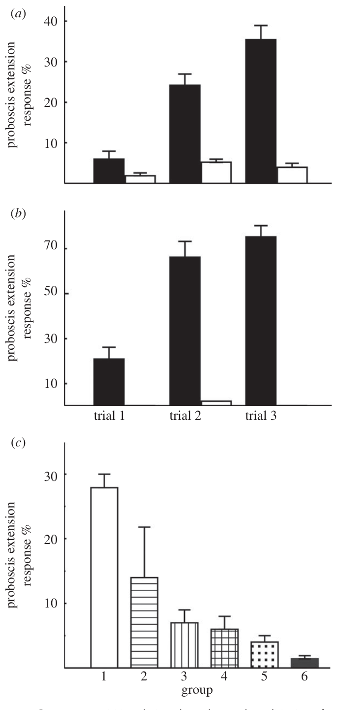
Antennal interventions reduce learned field responses
Greggers and colleagues paired an electric-field stimulus with sucrose and tested the conditioned proboscis extension response. Uncharged material or an inactive stimulus source served as the unrewarded comparison. Bees learned both constant fields and modulated stimulation at 60 Hz.
After learning, removing antennae eliminated the learned field response. Wax treatments that restricted antennal joints strongly reduced it; coating surfaces while retaining movement produced a less marked reduction. Learned responses to electric cues were also retained after 24 h.
The intervention pattern supports a contribution from antennal mechanoreception, including receptors associated with both joints. It does not isolate Johnston’s organ as the sole sensor or exclude every contribution from antennal surface hairs. The conditioning demonstrates a usable cue under controlled conditions, rather than its exclusive or necessary role in a crowded hive.
Kumaraswamy et al. (2019), Fig. 1a–c. Antennal input, mechanosensory neuropils and DL-Int-1.
Greggers et al. (2013), Fig. 7a–c. Associative learning after antennal interventions.
Greggers et al. (2013)
39
Notes:
• Greggers and colleagues paired an electric-field stimulus with sucrose and tested the conditioned proboscis extension response. Uncharged material or an inactive stimulus source served as the unrewarded comparison. Bees learned both constant fields and modulated stimulation at 60 Hz.
– Treating bees after conditioning separates sensory access at test from initial acquisition. Surface coating and joint restriction are different interventions and should not be treated as identical controls.
• After learning, removing antennae eliminated the learned field response. Wax treatments that restricted antennal joints strongly reduced it; coating surfaces while retaining movement produced a less marked reduction. Learned responses to electric cues were also retained after 24 h.
• The intervention pattern supports a contribution from antennal mechanoreception, including receptors associated with both joints. It does not isolate Johnston’s organ as the sole sensor or exclude every contribution from antennal surface hairs. The conditioning demonstrates a usable cue under controlled conditions, rather than its exclusive or necessary role in a crowded hive.
References:
Greggers U, Koch G, Schmidt V, Dürr A, Floriou-Servou A, Piepenbrock D, Göpfert MC, Menzel R (2013). Reception and learning of electric fields in bees. Proceedings of the Royal Society B: Biological Sciences 280(1759): 20130528. https://doi.org/10.1098/rspb.2013.0528
Kumaraswamy A, Ai H, Kai K, Ikeno H, Wachtler T (2019). Adaptations during Maturation in an Identified Honeybee Interneuron Responsive to Waggle Dance Vibration Signals. eNeuro 6(5): ENEURO.0454-18.2019. https://doi.org/10.1523/eneuro.0454-18.2019
Figure: Greggers et al. (2013), Fig. 7a–c. Associative learning after antennal interventions.
Figure source: https://doi.org/10.1098/rspb.2013.0528
Figure: Kumaraswamy et al. (2019), Fig. 1a–c. Antennal input, mechanosensory neuropils and DL-Int-1.
Figure source: https://doi.org/10.1523/eneuro.0454-18.2019

Slide 40
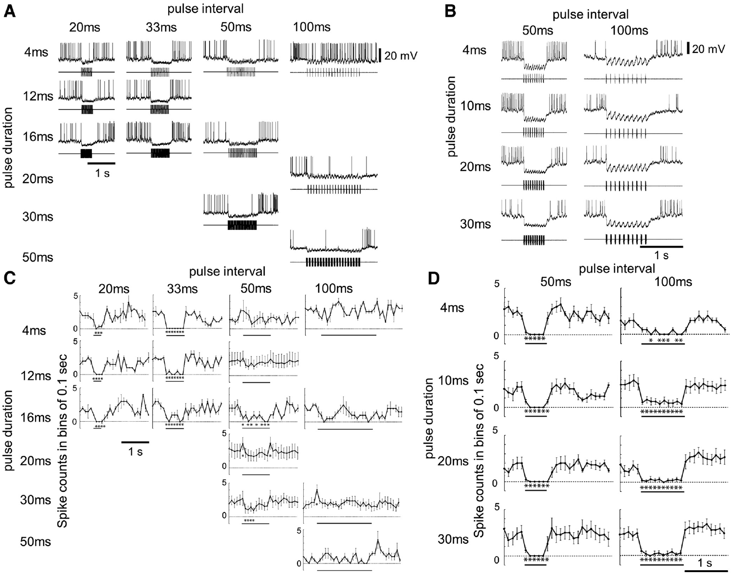
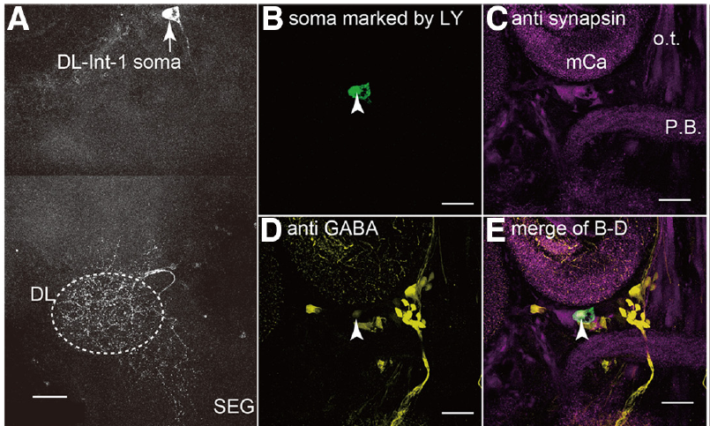
DL-Int-1 is GABA-positive and inhibited by pulse trains
Ai and colleagues recorded intracellularly from identified honeybee interneurons while a mechanical stimulator vibrated the antennal flagellum. DL-Int-1 branches in the dorsal lobe and related mechanosensory tissue. Dye filling and anti-GABA staining associated this cell type with a GABAergic phenotype.
The stimulus carrier was 265 Hz, within the wing-vibration range relevant to waggle dancing. Pulse trains with durations up to 16 ms and intervals up to 33 ms suppressed DL-Int-1 firing below its spontaneous level. Longer 100 ms intervals allowed intermittent spikes during the train.
Ai et al. (2017), Fig. 2A–E. DL-Int-1 morphology and GABA immunoreactivity.
This response distinguishes closely spaced vibration pulses from more widely spaced events. Antibody controls supported label specificity, but GABA staining does not prove a particular inhibitory connection to another named neuron. The cellular recording establishes temporal filtering without identifying the receptor or ion channel that generates the observed inhibitory potentials.
Ai et al. (2017), Fig. 3A–D. DL-Int-1 responses to pulse duration and interval.
Ai et al. (2017)
40
Notes:
• Ai and colleagues recorded intracellularly from identified honeybee interneurons while a mechanical stimulator vibrated the antennal flagellum. DL-Int-1 branches in the dorsal lobe and related mechanosensory tissue. Dye filling and anti-GABA staining associated this cell type with a GABAergic phenotype.
– Intracellular recording measures voltage changes and spikes in the same identified neuron. Suppression of this GABA-positive cell is different from evidence that its output inhibits a specific downstream cell.
• The stimulus carrier was 265 Hz, within the wing-vibration range relevant to waggle dancing. Pulse trains with durations up to 16 ms and intervals up to 33 ms suppressed DL-Int-1 firing below its spontaneous level. Longer 100 ms intervals allowed intermittent spikes during the train.
• This response distinguishes closely spaced vibration pulses from more widely spaced events. Antibody controls supported label specificity, but GABA staining does not prove a particular inhibitory connection to another named neuron. The cellular recording establishes temporal filtering without identifying the receptor or ion channel that generates the observed inhibitory potentials.
References:
Ai H, Kai K, Kumaraswamy A, Ikeno H, Wachtler T (2017). Interneurons in the Honeybee Primary Auditory Center Responding to Waggle Dance-Like Vibration Pulses. The Journal of Neuroscience 37(44): 10624-10635. https://doi.org/10.1523/jneurosci.0044-17.2017
Figure: Ai et al. (2017), Fig. 3A–D. DL-Int-1 responses to pulse duration and interval.
Figure source: https://doi.org/10.1523/jneurosci.0044-17.2017
Figure: Ai et al. (2017), Fig. 2A–E. DL-Int-1 morphology and GABA immunoreactivity.
Figure source: https://doi.org/10.1523/jneurosci.0044-17.2017

Slide 41
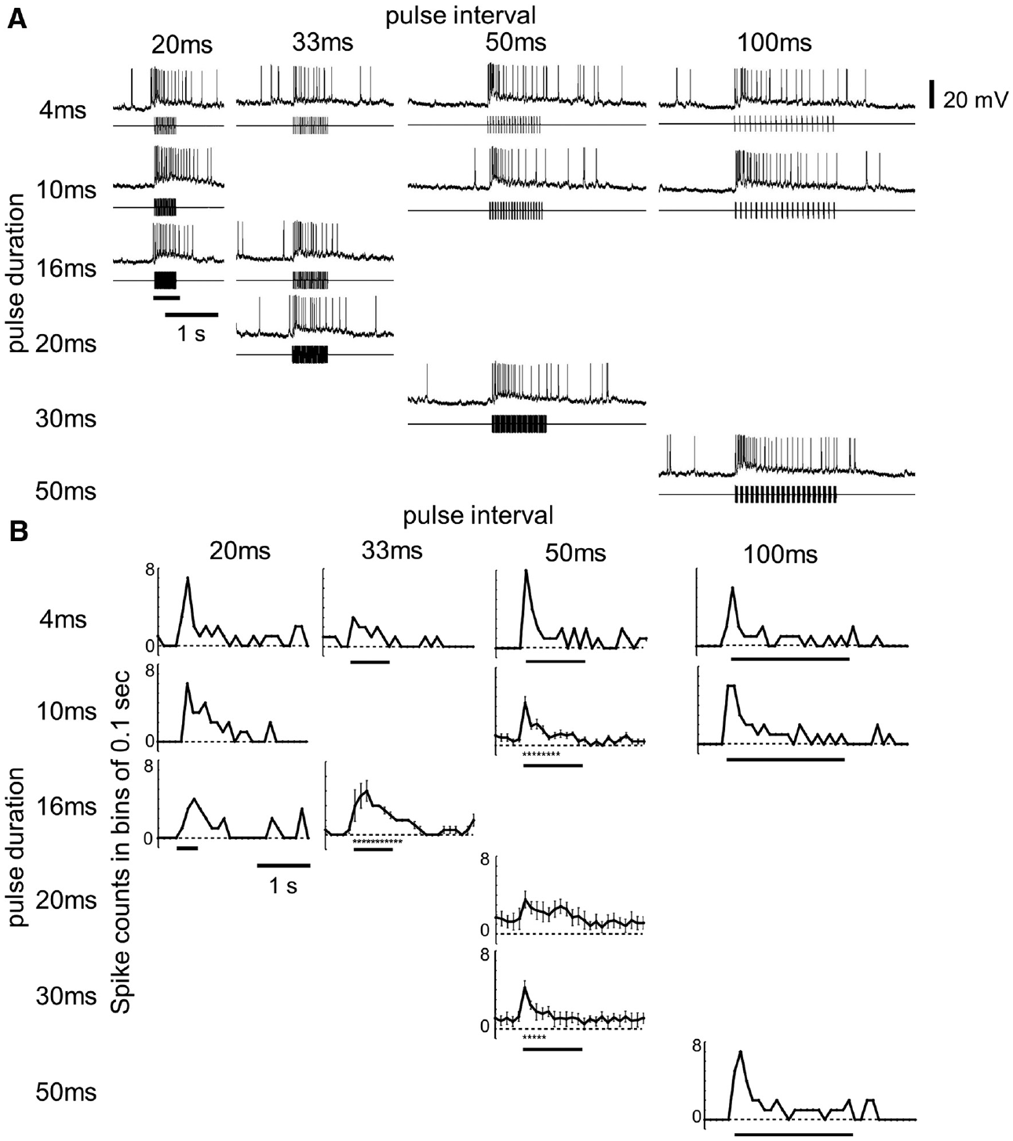
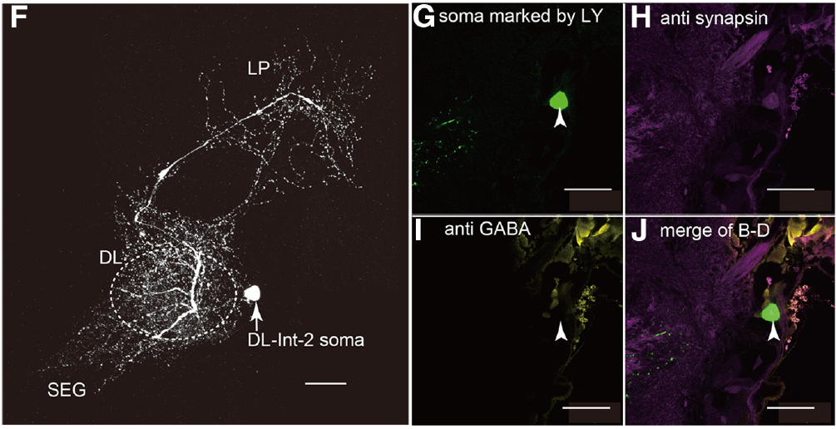
DL-Int-2 remains excited during dance-like vibration
Ai and colleagues found a different response in DL-Int-2, another identified interneuron in the primary mechanosensory processing region. Its soma did not coincide with the anti-GABA labeling observed for DL-Int-1; this negative label does not by itself identify its transmitter.
At a 265 Hz carrier, trains with 16 ms pulses and 33 ms intervals evoked an initial excitation followed by maintained excitation. In contrast, DL-Int-1 was suppressed during comparable short-interval stimulation. Tonic activity is sustained activity during a stimulus, whereas phasic activity is concentrated near a change such as onset.
Ai et al. (2017), Fig. 2F–J. DL-Int-2 morphology and transmitter-label controls.
The contrasting responses could allow pulse-train duration to influence downstream signaling. A proposed inhibitory relationship between the two cell types was supported by modeling and morphology, not by direct synaptic measurement. The recorded excitation must therefore be distinguished from a proven circuit for decoding advertised distance.
Ai et al. (2017), Fig. 4A,B. DL-Int-2 excitation during vibration pulse trains.
Ai et al. (2017)
41
Notes:
• Ai and colleagues found a different response in DL-Int-2, another identified interneuron in the primary mechanosensory processing region. Its soma did not coincide with the anti-GABA labeling observed for DL-Int-1; this negative label does not by itself identify its transmitter.
– The stimulus envelope and the carrier are different quantities. A 265 Hz vibration inside repeated pulses is not equivalent to a 265 Hz rate of whole waggle runs.
• At a 265 Hz carrier, trains with 16 ms pulses and 33 ms intervals evoked an initial excitation followed by maintained excitation. In contrast, DL-Int-1 was suppressed during comparable short-interval stimulation. Tonic activity is sustained activity during a stimulus, whereas phasic activity is concentrated near a change such as onset.
• The contrasting responses could allow pulse-train duration to influence downstream signaling. A proposed inhibitory relationship between the two cell types was supported by modeling and morphology, not by direct synaptic measurement. The recorded excitation must therefore be distinguished from a proven circuit for decoding advertised distance.
References:
Ai H, Kai K, Kumaraswamy A, Ikeno H, Wachtler T (2017). Interneurons in the Honeybee Primary Auditory Center Responding to Waggle Dance-Like Vibration Pulses. The Journal of Neuroscience 37(44): 10624-10635. https://doi.org/10.1523/jneurosci.0044-17.2017
Figure: Ai et al. (2017), Fig. 4A,B. DL-Int-2 excitation during vibration pulse trains.
Figure source: https://doi.org/10.1523/jneurosci.0044-17.2017
Figure: Ai et al. (2017), Fig. 2F–J. DL-Int-2 morphology and transmitter-label controls.
Figure source: https://doi.org/10.1523/jneurosci.0044-17.2017

Slide 42
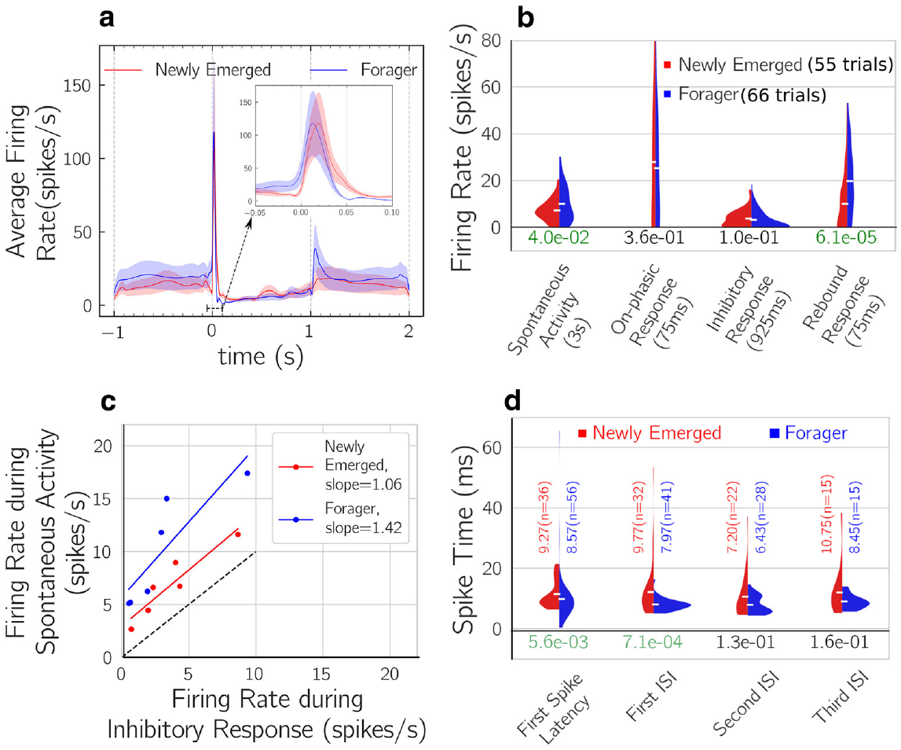
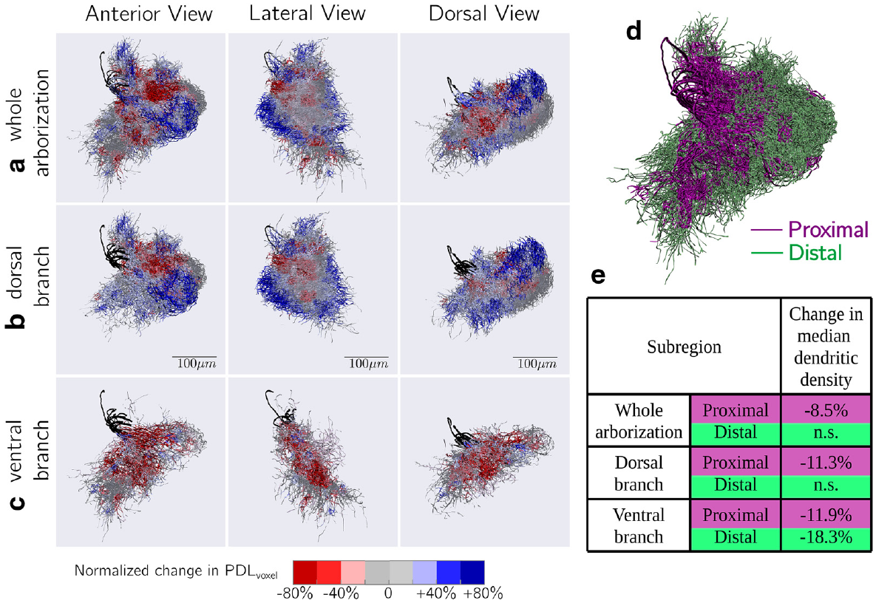
Mechanosensory responses change as workers mature
Kumaraswamy and colleagues compared DL-Int-1 in newly emerged workers aged 1–3 days with foragers older than 10 days. The preparation combined intracellular recording with dye-filled morphology, allowing cell identity to be retained across the age comparison.
Gross arborization extent was similar between groups, but branch density differed in selected regions. Foragers’ responses showed a stronger contrast between spontaneous activity and vibration-evoked inhibition, giving the stimulus a more distinct temporal signature. The original reconstructions and response distributions document different levels of analysis.
Kumaraswamy et al. (2019), Fig. 3a,b. Reconstructed DL-Int-1 arborizations during maturation.
Maturation can change signal processing without replacing a neuron’s overall projection pattern. Age and experience were not independently manipulated, however, so the differences cannot be assigned exclusively to dance learning. The comparison establishes developmental association rather than the cellular cause of an acquired navigational skill.
Kumaraswamy et al. (2019), Fig. 5a–d. Neuronal response distributions in young bees and foragers.
Kumaraswamy et al. (2019)
42
Notes:
• Kumaraswamy and colleagues compared DL-Int-1 in newly emerged workers aged 1–3 days with foragers older than 10 days. The preparation combined intracellular recording with dye-filled morphology, allowing cell identity to be retained across the age comparison.
– Young bees had been maintained in cages, while foragers had natural behavioral experience. That group difference limits any claim that age alone or dance experience alone caused the response changes.
• Gross arborization extent was similar between groups, but branch density differed in selected regions. Foragers’ responses showed a stronger contrast between spontaneous activity and vibration-evoked inhibition, giving the stimulus a more distinct temporal signature. The original reconstructions and response distributions document different levels of analysis.
• Maturation can change signal processing without replacing a neuron’s overall projection pattern. Age and experience were not independently manipulated, however, so the differences cannot be assigned exclusively to dance learning. The comparison establishes developmental association rather than the cellular cause of an acquired navigational skill.
References:
Kumaraswamy A, Ai H, Kai K, Ikeno H, Wachtler T (2019). Adaptations during Maturation in an Identified Honeybee Interneuron Responsive to Waggle Dance Vibration Signals. eNeuro 6(5): ENEURO.0454-18.2019. https://doi.org/10.1523/eneuro.0454-18.2019
Figure: Kumaraswamy et al. (2019), Fig. 5a–d. Neuronal response distributions in young bees and foragers.
Figure source: https://doi.org/10.1523/eneuro.0454-18.2019
Figure: Kumaraswamy et al. (2019), Fig. 3a,b. Reconstructed DL-Int-1 arborizations during maturation.
Figure source: https://doi.org/10.1523/eneuro.0454-18.2019

Slide 43
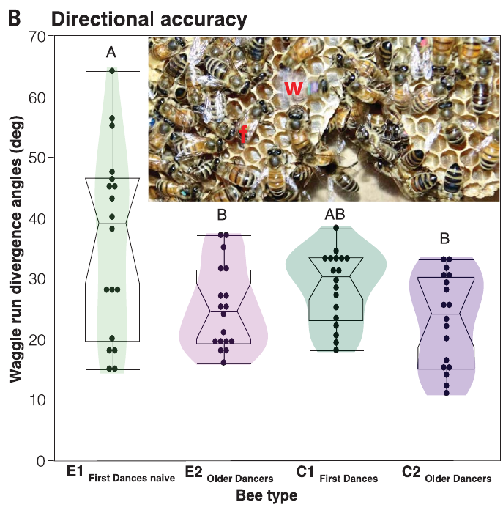
Experienced dancers improve novices’ directional precision
Dong and colleagues created colonies of newly emerged workers with no experienced dancers and compared them with mixed-age colonies. Individually marked bees first danced for a feeder 150 m away; the same bees were tested again 20 days later.
Bees that could not follow experienced dancers before their first dance produced larger waggle-angle divergence and more disordered movements. Their directional precision improved by the later test. First dances in mixed-age colonies were already more precise, separating early social exposure from the act of merely performing a dance.
The result supports social contributions to dance development alongside an inherited behavioral pattern. Later improvement could reflect age, flight practice, following experience or their combination. Colony composition changes several experiences together, so the study does not isolate a single teaching interaction or a synaptic learning rule.
Dong et al. (2023), Fig. 1B. Directional divergence before and after dance experience.
Dong et al. (2023)
43
Notes:
• Dong and colleagues created colonies of newly emerged workers with no experienced dancers and compared them with mixed-age colonies. Individually marked bees first danced for a feeder 150 m away; the same bees were tested again 20 days later.
– Directional divergence measures variation among waggle runs, not necessarily a systematic bias in the average advertised compass bearing. Those two kinds of error have different consequences for followers.
• Bees that could not follow experienced dancers before their first dance produced larger waggle-angle divergence and more disordered movements. Their directional precision improved by the later test. First dances in mixed-age colonies were already more precise, separating early social exposure from the act of merely performing a dance.
• The result supports social contributions to dance development alongside an inherited behavioral pattern. Later improvement could reflect age, flight practice, following experience or their combination. Colony composition changes several experiences together, so the study does not isolate a single teaching interaction or a synaptic learning rule.
References:
Dong S, Lin T, Nieh JC, Tan K (2023). Social signal learning of the waggle dance in honey bees. Science 379(6636): 1015-1018. https://doi.org/10.1126/science.ade1702
Figure: Dong et al. (2023), Fig. 1B. Directional divergence before and after dance experience.
Figure source: https://doi.org/10.1126/science.ade1702

Slide 44
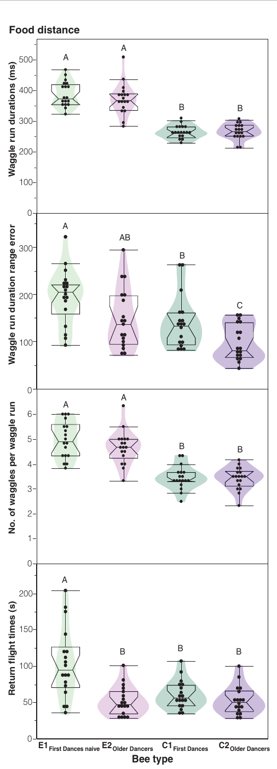
Early social experience leaves a lasting distance bias
In Dong and colleagues’ 150 m feeder preparation, naive first dancers produced longer waggle runs and more waggles per run than first dancers from mixed-age colonies. The altered timing advertised a greater distance despite the common food location.
Twenty days later, the previously naive bees still produced the elevated distance signal. Their return-flight times had improved, and their directional precision had recovered, but the distance difference remained. The persistence separates distance calibration from changes that become more normal with later foraging experience.
Social experience therefore influences different components of the dance differently. Persistence through the measured adult interval supports a lasting calibration effect; it is not a longitudinal measurement of every future dance throughout a bee’s life. The experiment does not identify the sensory or neural mechanism storing that early calibration.
Dong et al. (2023), Fig. 2. Dance distance signals and return flights over time.
Dong et al. (2023)
44
Notes:
• In Dong and colleagues’ 150 m feeder preparation, naive first dancers produced longer waggle runs and more waggles per run than first dancers from mixed-age colonies. The altered timing advertised a greater distance despite the common food location.
– The feeder remained at the same distance for the group comparison. An improved return flight and a persistently long dance signal cannot be collapsed into one general measure of experience.
• Twenty days later, the previously naive bees still produced the elevated distance signal. Their return-flight times had improved, and their directional precision had recovered, but the distance difference remained. The persistence separates distance calibration from changes that become more normal with later foraging experience.
• Social experience therefore influences different components of the dance differently. Persistence through the measured adult interval supports a lasting calibration effect; it is not a longitudinal measurement of every future dance throughout a bee’s life. The experiment does not identify the sensory or neural mechanism storing that early calibration.
References:
Dong S, Lin T, Nieh JC, Tan K (2023). Social signal learning of the waggle dance in honey bees. Science 379(6636): 1015-1018. https://doi.org/10.1126/science.ade1702
Figure: Dong et al. (2023), Fig. 2. Dance distance signals and return flights over time.
Figure source: https://doi.org/10.1126/science.ade1702

Slide 45
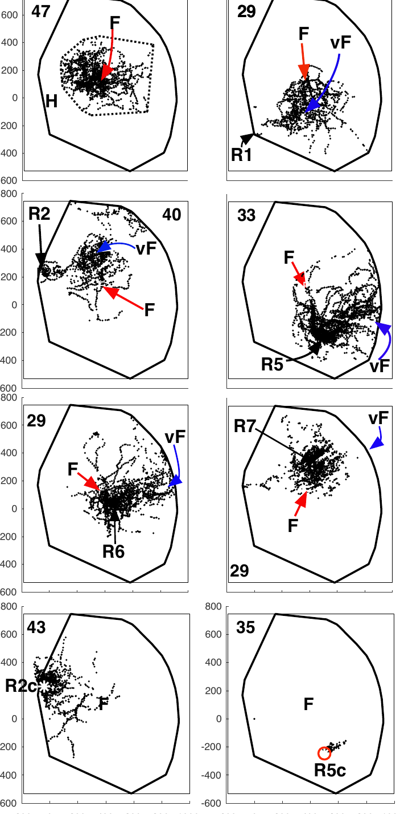
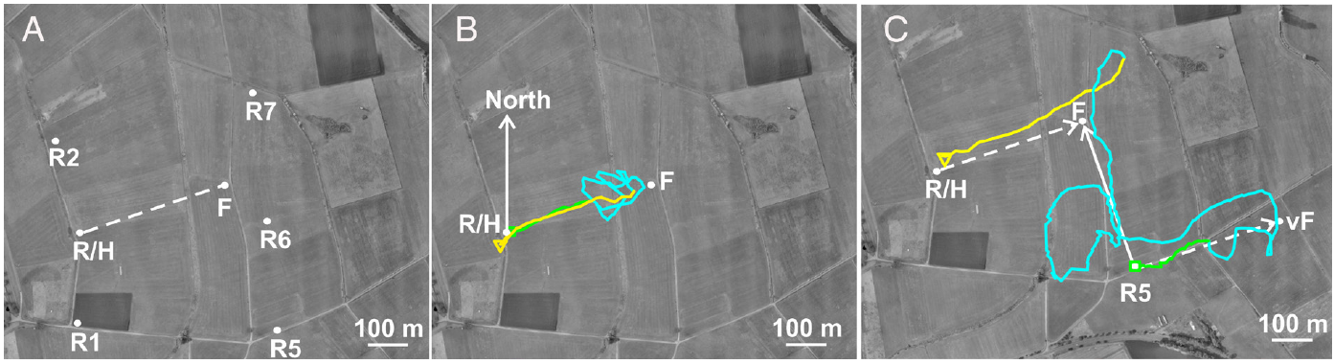
Landscape knowledge can modify the recruit’s later search
Wang and colleagues tracked dance followers released either at the hive or at displaced sites within an explored landscape. The recruits had never visited the advertised food source. Harmonic radar sampled flight positions every 3 s.
Both groups first flew approximately the communicated vector. During later search, displaced recruits directed more behavior toward the real feeder location than toward the virtual endpoint obtained by executing that vector from the wrong origin. Search could therefore incorporate landscape knowledge acquired before the recruitment event.
Wang et al. (2023), Fig. 1A–C. Experimental landscape and radar trajectories.
The authors interpreted this behavior as inference of source location using map-like spatial knowledge. It does not directly record a neural map, and familiar visual guidance must be distinguished from a purely metric representation. The contrast with Riley’s sparse-terrain experiment emphasizes the separate contributions of initial vector flight and subsequent search.
Wang et al. (2023), Fig. 4. Search distributions relative to real and virtual feeders.
Wang et al. (2023); Riley et al. (2005)
45
Notes:
• Wang and colleagues tracked dance followers released either at the hive or at displaced sites within an explored landscape. The recruits had never visited the advertised food source. Harmonic radar sampled flight positions every 3 s.
– The virtual endpoint is a predicted destination from an origin-dependent instruction, not a second feeder presented to the bee. The real and virtual alternatives distinguish later source-directed search from continuing the displaced vector.
• Both groups first flew approximately the communicated vector. During later search, displaced recruits directed more behavior toward the real feeder location than toward the virtual endpoint obtained by executing that vector from the wrong origin. Search could therefore incorporate landscape knowledge acquired before the recruitment event.
• The authors interpreted this behavior as inference of source location using map-like spatial knowledge. It does not directly record a neural map, and familiar visual guidance must be distinguished from a purely metric representation. The contrast with Riley’s sparse-terrain experiment emphasizes the separate contributions of initial vector flight and subsequent search.
References:
Wang Z, Chen X, Becker F, Greggers U, Walter S, Werner M, Gallistel CR, Menzel R (2023). Honey bees infer source location from the dances of returning foragers. Proceedings of the National Academy of Sciences 120(12): e2213068120. https://doi.org/10.1073/pnas.2213068120
Riley JR, Greggers U, Smith AD, Reynolds DR, Menzel R (2005). The flight paths of honeybees recruited by the waggle dance. Nature 435(7039): 205-207. https://doi.org/10.1038/nature03526
Figure: Wang et al. (2023), Fig. 4. Search distributions relative to real and virtual feeders.
Figure source: https://doi.org/10.1073/pnas.2213068120
Figure: Wang et al. (2023), Fig. 1A–C. Experimental landscape and radar trajectories.
Figure source: https://doi.org/10.1073/pnas.2213068120

Slide 46
Key takeaways
Dance vectors Waggle-run angle specifies direction relative to the sun; duration specifies a visually calibrated distance from the hive. Vector flight and terminal source search are distinct.
Visual odometry Optic flow changes dance duration and recruit search distance. Tunnel texture and natural terrain prevent a universal conversion from duration to physical meters.
Time compensation Bees refine the local solar course through experience. Circadian phase disruption causes sun-compass errors whose direction depends on hemisphere.
Compass pathways Ultraviolet-sensitive dorsal-rim input reaches the medulla, optic tubercle, bulbs and central body. Tracing establishes anatomy; candidate timing contacts require functional tests.
Dance-signal processing Antennal movement activates mechanosensory pathways. Identified interneurons filter vibration pulse trains, but their proposed inhibitory connections and distance-decoding role are not fully established.
Experience and search Early social experience affects dance precision and lasting distance calibration. Familiar landscape knowledge can influence later search without replacing the initial dance vector.
Riley et al. (2005); Dong et al. (2023); Srinivasan et al. (2000); Zeller et al. (2015)
46
Notes:
• Dance vectors. Waggle-run angle specifies direction relative to the sun; duration specifies a visually calibrated distance from the hive. Vector flight and terminal source search are distinct.
• Visual odometry. Optic flow changes dance duration and recruit search distance. Tunnel texture and natural terrain prevent a universal conversion from duration to physical meters.
• Time compensation. Bees refine the local solar course through experience. Circadian phase disruption causes sun-compass errors whose direction depends on hemisphere.
• Compass pathways. Ultraviolet-sensitive dorsal-rim input reaches the medulla, optic tubercle, bulbs and central body. Tracing establishes anatomy; candidate timing contacts require functional tests.
• Dance-signal processing. Antennal movement activates mechanosensory pathways. Identified interneurons filter vibration pulse trains, but their proposed inhibitory connections and distance-decoding role are not fully established.
• Experience and search. Early social experience affects dance precision and lasting distance calibration. Familiar landscape knowledge can influence later search without replacing the initial dance vector.
References:
von Frisch K, Lindauer M (1954). Himmel und Erde in Konkurrenz bei der Orientierung der Bienen. Die Naturwissenschaften 41(11): 245-253. https://doi.org/10.1007/bf00634944
Srinivasan MV, Zhang S, Altwein M, Tautz J (2000). Honeybee Navigation: Nature and Calibration of the "Odometer". Science 287(5454): 851-853. https://doi.org/10.1126/science.287.5454.851
Esch HE, Zhang S, Srinivasan MV, Tautz J (2001). Honeybee dances communicate distances measured by optic flow. Nature 411(6837): 581-583. https://doi.org/10.1038/35079072
Riley JR, Greggers U, Smith AD, Reynolds DR, Menzel R (2005). The flight paths of honeybees recruited by the waggle dance. Nature 435(7039): 205-207. https://doi.org/10.1038/nature03526
Dong S, Lin T, Nieh JC, Tan K (2023). Social signal learning of the waggle dance in honey bees. Science 379(6636): 1015-1018. https://doi.org/10.1126/science.ade1702
Cheeseman JF, Winnebeck EC, Millar CD, Kirkland LS, Sleigh J, Goodwin M, Pawley MDM, Bloch G, Lehmann K, Menzel R, Warman GR (2012). General anesthesia alters time perception by phase shifting the circadian clock. Proceedings of the National Academy of Sciences 109(18): 7061-7066. https://doi.org/10.1073/pnas.1201734109
Wang Z, Chen X, Becker F, Greggers U, Walter S, Werner M, Gallistel CR, Menzel R (2023). Honey bees infer source location from the dances of returning foragers. Proceedings of the National Academy of Sciences 120(12): e2213068120. https://doi.org/10.1073/pnas.2213068120
Greggers U, Koch G, Schmidt V, Dürr A, Floriou-Servou A, Piepenbrock D, Göpfert MC, Menzel R (2013). Reception and learning of electric fields in bees. Proceedings of the Royal Society B: Biological Sciences 280(1759): 20130528. https://doi.org/10.1098/rspb.2013.0528
Kumaraswamy A, Ai H, Kai K, Ikeno H, Wachtler T (2019). Adaptations during Maturation in an Identified Honeybee Interneuron Responsive to Waggle Dance Vibration Signals. eNeuro 6(5): ENEURO.0454-18.2019. https://doi.org/10.1523/eneuro.0454-18.2019
Held M, Berz A, Hensgen R, Muenz TS, Scholl C, Rössler W, Homberg U, Pfeiffer K (2016). Microglomerular Synaptic Complexes in the Sky-Compass Network of the Honeybee Connect Parallel Pathways from the Anterior Optic Tubercle to the Central Complex. Frontiers in Behavioral Neuroscience 10: 186. https://doi.org/10.3389/fnbeh.2016.00186
Sakura M, Okada R, Aonuma H (2012). Evidence for instantaneous e-vector detection in the honeybee using an associative learning paradigm. Proceedings of the Royal Society B: Biological Sciences 279(1728): 535-542. https://doi.org/10.1098/rspb.2011.0929
Evangelista C, Kraft P, Dacke M, Labhart T, Srinivasan MV (2014). Honeybee navigation: critically examining the role of the polarization compass. Philosophical Transactions of the Royal Society B: Biological Sciences 369(1636): 20130037. https://doi.org/10.1098/rstb.2013.0037
Kraft P, Evangelista C, Dacke M, Labhart T, Srinivasan MV (2011). Honeybee navigation: following routes using polarized-light cues. Philosophical Transactions of the Royal Society B: Biological Sciences 366(1565): 703-708. https://doi.org/10.1098/rstb.2010.0203
Dyer FC, Dickinson JA (1994). Development of sun compensation by honeybees: how partially experienced bees estimate the sun's course. Proceedings of the National Academy of Sciences 91(10): 4471-4474. https://doi.org/10.1073/pnas.91.10.4471
Tautz J, Zhang S, Spaethe J, Brockmann A, Si A, Srinivasan M (2004). Honeybee Odometry: Performance in Varying Natural Terrain. PLoS Biology 2(7): e211. https://doi.org/10.1371/journal.pbio.0020211
Zeller M, Held M, Bender J, Berz A, Heinloth T, Hellfritz T, Pfeiffer K (2015). Transmedulla Neurons in the Sky Compass Network of the Honeybee (Apis mellifera) Are a Possible Site of Circadian Input. PLOS ONE 10(12): e0143244. https://doi.org/10.1371/journal.pone.0143244
Ai H, Kai K, Kumaraswamy A, Ikeno H, Wachtler T (2017). Interneurons in the Honeybee Primary Auditory Center Responding to Waggle Dance-Like Vibration Pulses. The Journal of Neuroscience 37(44): 10624-10635. https://doi.org/10.1523/jneurosci.0044-17.2017

