Slide 1
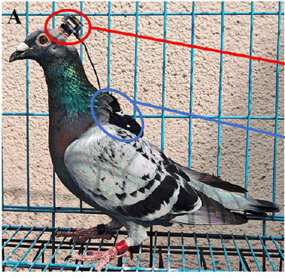
NEUR 411 · NEUROETHOLOGY · FALL 2026
Lecture 31
Navigation IV:
homing pigeon multimodal navigation
Friday, November 6, 2026
Jordan Lopez, Ph.D.
Professor of Neurobiology & Biomedical Engineering
Yang et al. (2025), Fig. 1A. A pigeon wearing the neural and positional recording devices.
Notes:
Navigation IV: homing pigeon multimodal navigation
Lecture 31. NEUR 411 · NEUROETHOLOGY · FALL 2026. Friday, November 6, 2026.
Figure: Yang et al. (2025), Fig. 1A. A pigeon wearing the neural and positional recording devices.
Figure source: https://doi.org/10.1523/JNEUROSCI.0185-25.2025

Slide 2
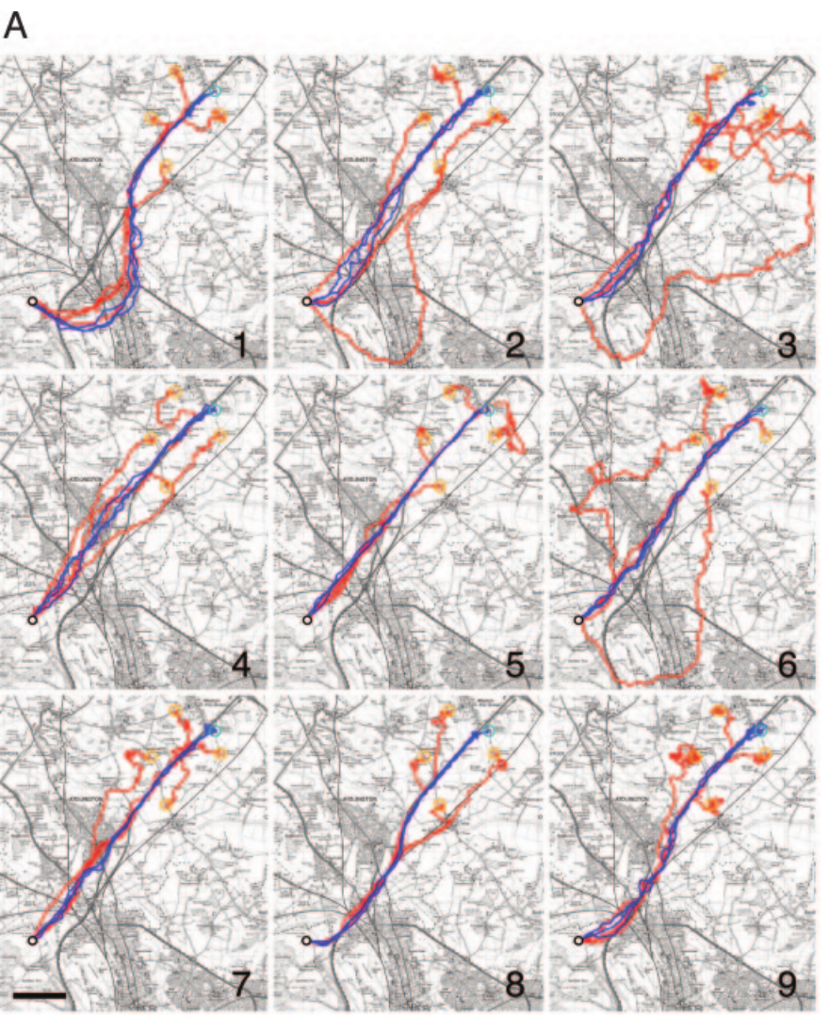
Homing uses location estimates and directional guidance
Homing is navigation back to a familiar home after displacement. In pigeons, a map estimates position relative to home, whereas a compass supplies a directional reference. These are functional distinctions; the word map does not by itself imply a complete mental representation of geography.
Biro and colleagues recorded homing pigeons with a global positioning system, or GPS, logging position every 1 s. Repeated releases and off-route tests separated following a familiar corridor from taking the shortest available course home.
Birds repeatedly used individually distinctive routes rather than converging on one direct line. Such route guidance can coexist with other location and compass information; the GPS tracks do not identify which sensory signal first establishes position at an unfamiliar release site.
Biro et al. (2004), Fig. 1A. Training and off-route homing tracks at Weston Wood.
Biro et al. (2004)
02
Notes:
• **Homing** is navigation back to a familiar home after displacement. In pigeons, a **map** estimates position relative to home, whereas a **compass** supplies a directional reference. These are functional distinctions; the word map does not by itself imply a complete mental representation of geography.
• Biro and colleagues recorded homing pigeons with a **global positioning system**, or GPS, logging position every 1 s. Repeated releases and off-route tests separated following a familiar corridor from taking the shortest available course home.
• Birds repeatedly used individually distinctive routes rather than converging on one direct line. Such route guidance can coexist with other location and compass information; the GPS tracks do not identify which sensory signal first establishes position at an unfamiliar release site.
References:
Biro D, Meade J, Guilford T (2004). Familiar route loyalty implies visual pilotage in the homing pigeon. Proceedings of the National Academy of Sciences 101(50):17440–17443. https://doi.org/10.1073/pnas.0406984101
Figure: Biro et al. (2004), Fig. 1A. Training and off-route homing tracks at Weston Wood.
Figure source: https://doi.org/10.1073/pnas.0406984101

Slide 3
Repeated journeys establish narrow individual corridors
Route fidelity is repeated use of a similar path by the same animal. It differs from accuracy of arrival: a pigeon can reach home along a reliable but indirect corridor. Biro and colleagues compared the last three training flights from each release site.
After repeated homing experience, mean corridor widths were 151 m at Weston Wood and 176 m at High Cogges. These widths describe the area enclosed by each bird’s final training tracks relative to its route length, rather than the uncertainty of a neural location code.
Tracks from the same bird were more similar than tracks from different birds. Individuality argues against a single obligatory physical corridor, although shared terrain and weather can still constrain available paths without determining the particular route learned by each pigeon.
Biro et al. (2004), Fig. 1A. Training and off-route homing tracks at Weston Wood.
Biro et al. (2004)
03
Notes:
• **Route fidelity** is repeated use of a similar path by the same animal. It differs from accuracy of arrival: a pigeon can reach home along a reliable but indirect corridor. Biro and colleagues compared the last three training flights from each release site.
• After repeated homing experience, mean corridor widths were 151 m at Weston Wood and 176 m at High Cogges. These widths describe the area enclosed by each bird’s final training tracks relative to its route length, rather than the uncertainty of a neural location code.
• Tracks from the same bird were more similar than tracks from different birds. Individuality argues against a single obligatory physical corridor, although shared terrain and weather can still constrain available paths without determining the particular route learned by each pigeon.
References:
Biro D, Meade J, Guilford T (2004). Familiar route loyalty implies visual pilotage in the homing pigeon. Proceedings of the National Academy of Sciences 101(50):17440–17443. https://doi.org/10.1073/pnas.0406984101
Figure: Biro et al. (2004), Fig. 1A. Training and off-route homing tracks at Weston Wood.
Figure source: https://doi.org/10.1073/pnas.0406984101

Slide 4
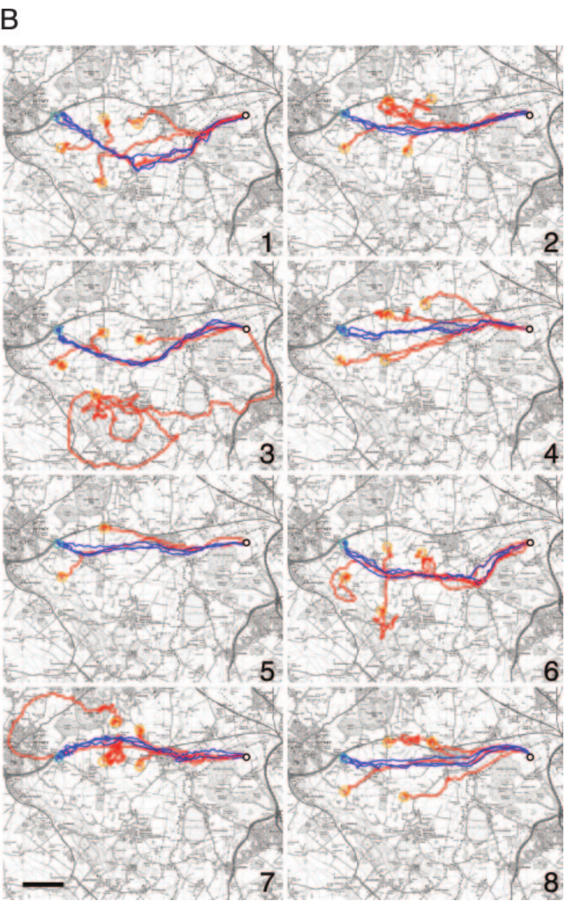
A familiar route need not minimize distance
Route efficiency compares the direct home distance with the distance actually flown. A lower value means a longer journey, even if the bird ultimately reaches the loft. Efficiency and fidelity therefore measure different properties of successful homing.
Biro and colleagues found that final training routes remained indirect after 20 successive releases. Birds flew approximately 18–25% farther than the direct home distance, while continuing to reproduce their individually distinctive paths. The GPS records retained the turns that would be lost in a single departure bearing.
Persistent detours support learned route guidance rather than progressive convergence on the shortest path. They do not establish that a detour is maladaptive: the experiment did not measure all ecological costs, visual reliability or risks along alternative routes.
Biro et al. (2004), Fig. 1B. Training and off-route homing tracks at High Cogges.
Biro et al. (2004)
04
Notes:
• **Route efficiency** compares the direct home distance with the distance actually flown. A lower value means a longer journey, even if the bird ultimately reaches the loft. Efficiency and fidelity therefore measure different properties of successful homing.
• Biro and colleagues found that final training routes remained indirect after 20 successive releases. Birds flew approximately 18–25% farther than the direct home distance, while continuing to reproduce their individually distinctive paths. The GPS records retained the turns that would be lost in a single departure bearing.
• Persistent detours support learned route guidance rather than progressive convergence on the shortest path. They do not establish that a detour is maladaptive: the experiment did not measure all ecological costs, visual reliability or risks along alternative routes.
References:
Biro D, Meade J, Guilford T (2004). Familiar route loyalty implies visual pilotage in the homing pigeon. Proceedings of the National Academy of Sciences 101(50):17440–17443. https://doi.org/10.1073/pnas.0406984101
Figure: Biro et al. (2004), Fig. 1B. Training and off-route homing tracks at High Cogges.
Figure source: https://doi.org/10.1073/pnas.0406984101

Slide 5
Off-route release tests attraction to a learned corridor
A displacement away from a trained release point separates recognition of the starting location from recognition of features along an established route. Biro and colleagues released trained pigeons at positions outside their preferred corridors and recorded their complete homing tracks.
The off-route tracks often converged on the previously used route before continuing toward the loft. The original maps preserve both training tracks and later test tracks, with a 2 km scale for comparing the displacement with the surrounding landscape.
Convergence is consistent with attraction toward familiar visual landmarks rather than a newly selected direct course from the test site. The experiment does not imply that every off-route flight used visual information exclusively, because other navigational systems remained available throughout the journey.
Biro et al. (2004), Fig. 1A. Training and off-route homing tracks at Weston Wood.
Biro et al. (2004)
05
Notes:
• A displacement away from a trained release point separates recognition of the starting location from recognition of features along an established route. Biro and colleagues released trained pigeons at positions outside their preferred corridors and recorded their complete homing tracks.
• The off-route tracks often converged on the previously used route before continuing toward the loft. The original maps preserve both training tracks and later test tracks, with a 2 km scale for comparing the displacement with the surrounding landscape.
• Convergence is consistent with attraction toward familiar visual landmarks rather than a newly selected direct course from the test site. The experiment does not imply that every off-route flight used visual information exclusively, because other navigational systems remained available throughout the journey.
References:
Biro D, Meade J, Guilford T (2004). Familiar route loyalty implies visual pilotage in the homing pigeon. Proceedings of the National Academy of Sciences 101(50):17440–17443. https://doi.org/10.1073/pnas.0406984101
Figure: Biro et al. (2004), Fig. 1A. Training and off-route homing tracks at Weston Wood.
Figure source: https://doi.org/10.1073/pnas.0406984101

Slide 6
Pilotage links movement to recognized landmarks
Visual pilotage means using recognized landscape features to guide movement along a familiar route. A landmark can provide local guidance without representing the bird’s position in a universal coordinate system. The route may be learned as a succession of familiar places.
Biro and colleagues compared repeated training flights with off-route releases in the same landscape. Birds were attracted toward their preferred corridors even when this required an indirect journey. The 2 km map scale places these deviations beyond small fluctuations around a single straight course.
The behavior supports route-based visual guidance, but GPS alone cannot determine which particular feature controlled each turn. It also cannot distinguish a continuous visual panorama from a succession of discrete landmarks without additional manipulation of the visual information.
Biro et al. (2004), Fig. 1B. Training and off-route homing tracks at High Cogges.
Biro et al. (2004)
06
Notes:
• **Visual pilotage** means using recognized landscape features to guide movement along a familiar route. A landmark can provide local guidance without representing the bird’s position in a universal coordinate system. The route may be learned as a succession of familiar places.
• Biro and colleagues compared repeated training flights with off-route releases in the same landscape. Birds were attracted toward their preferred corridors even when this required an indirect journey. The 2 km map scale places these deviations beyond small fluctuations around a single straight course.
• The behavior supports route-based visual guidance, but GPS alone cannot determine which particular feature controlled each turn. It also cannot distinguish a continuous visual panorama from a succession of discrete landmarks without additional manipulation of the visual information.
References:
Biro D, Meade J, Guilford T (2004). Familiar route loyalty implies visual pilotage in the homing pigeon. Proceedings of the National Academy of Sciences 101(50):17440–17443. https://doi.org/10.1073/pnas.0406984101
Figure: Biro et al. (2004), Fig. 1B. Training and off-route homing tracks at High Cogges.
Figure source: https://doi.org/10.1073/pnas.0406984101

Slide 7
Individual routes distinguish memory from common terrain
A common landscape can constrain flight without forcing all birds onto identical routes. Comparing different pigeons within that same terrain separates a shared environmental influence from an individual’s accumulated experience with particular features.
The training and off-route maps contain clearly different paths for pigeons returning to the same loft. Within-bird training corridors averaged 151 m at Weston Wood, whereas routes from different birds overlapped less closely. The geographical target was shared while the preferred trajectory was individual.
This comparison supports an acquired route memory rather than a single obligatory terrain channel. It does not specify the memory’s neural location or prove that all routes were learned independently of social experience; the tracked tests concern individual expression of homing behavior.
Biro et al. (2004), Fig. 1A. Training and off-route homing tracks at Weston Wood.
Biro et al. (2004)
07
Notes:
• A common landscape can constrain flight without forcing all birds onto identical routes. Comparing different pigeons within that same terrain separates a shared environmental influence from an individual’s accumulated experience with particular features.
• The training and off-route maps contain clearly different paths for pigeons returning to the same loft. Within-bird training corridors averaged 151 m at Weston Wood, whereas routes from different birds overlapped less closely. The geographical target was shared while the preferred trajectory was individual.
• This comparison supports an acquired route memory rather than a single obligatory terrain channel. It does not specify the memory’s neural location or prove that all routes were learned independently of social experience; the tracked tests concern individual expression of homing behavior.
References:
Biro D, Meade J, Guilford T (2004). Familiar route loyalty implies visual pilotage in the homing pigeon. Proceedings of the National Academy of Sciences 101(50):17440–17443. https://doi.org/10.1073/pnas.0406984101
Figure: Biro et al. (2004), Fig. 1A. Training and off-route homing tracks at Weston Wood.
Figure source: https://doi.org/10.1073/pnas.0406984101

Slide 8
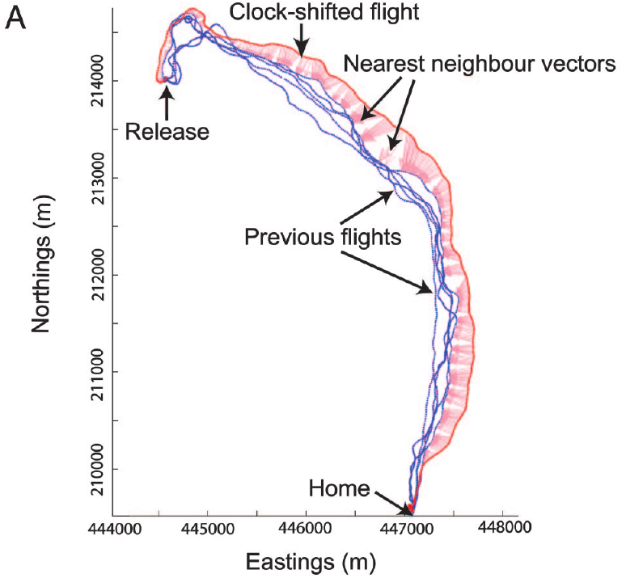
Clock shift makes solar direction conflict with landmarks
A time-compensated sun compass uses the sun’s position together with internal time to estimate direction. Because solar position changes across the day, altering the bird’s internal clock can change its inferred direction while leaving the landscape physically unchanged.
Biro and colleagues delayed artificial sunrise and sunset by 4 h for 5–7 days. This treatment predicted a solar-compass error of approximately 90° at the release dates. GPS tracks after treatment were compared with each bird’s own earlier flights.
The manipulation creates a conflict between a familiar visual route and compass information. A displaced course supports continued use of time-dependent directional information, but the treatment does not remove landmarks or establish that the sun is the only remaining compass cue.
Biro et al. (2007), Fig. 2A. A clock-shifted track and nearest-neighbour vectors.
Biro et al. (2007)
08
Notes:
• A **time-compensated sun compass** uses the sun’s position together with internal time to estimate direction. Because solar position changes across the day, altering the bird’s internal clock can change its inferred direction while leaving the landscape physically unchanged.
• Biro and colleagues delayed artificial sunrise and sunset by 4 h for 5–7 days. This treatment predicted a solar-compass error of approximately 90° at the release dates. GPS tracks after treatment were compared with each bird’s own earlier flights.
• The manipulation creates a conflict between a familiar visual route and compass information. A displaced course supports continued use of time-dependent directional information, but the treatment does not remove landmarks or establish that the sun is the only remaining compass cue.
References:
Biro D, Freeman R, Meade J, Roberts S, Guilford T (2007). Pigeons combine compass and landmark guidance in familiar route navigation. Proceedings of the National Academy of Sciences 104(18):7471–7476. https://doi.org/10.1073/pnas.0701575104
Figure: Biro et al. (2007), Fig. 2A. A clock-shifted track and nearest-neighbour vectors.
Figure source: https://doi.org/10.1073/pnas.0701575104

Slide 9
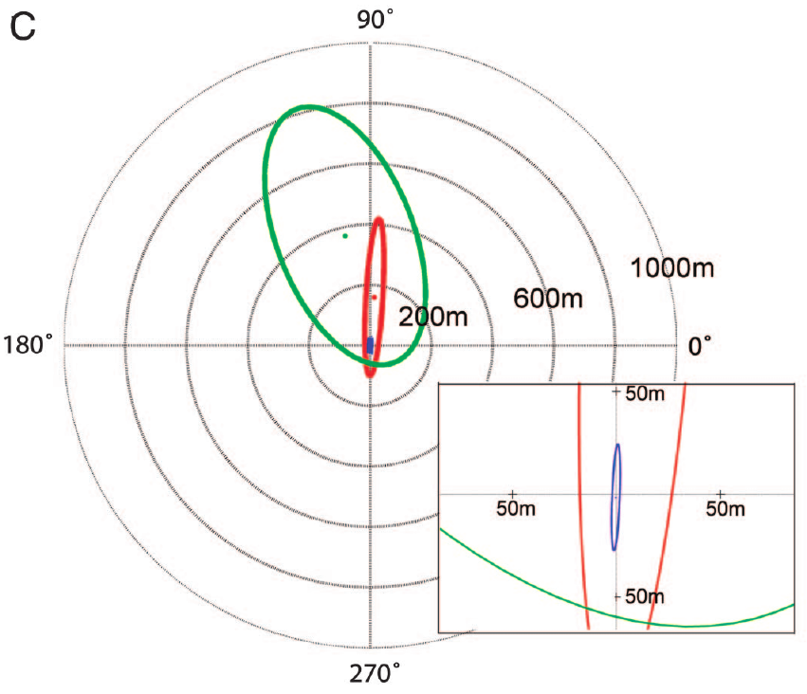
Experience changes the effect of conflicting cues
Cue weighting describes the relative influence of different information sources on behavior. It need not imply a conscious decision or a single identifiable neuron that assigns numerical weights. Familiarity can alter how strongly a recognized route constrains compass-guided movement.
Biro and colleagues compared high-familiarity birds with low-familiarity birds at four sites 5.1–10.6 km from the loft. After the same clock shift, highly familiar birds generally remained closer to their previous tracks, whereas less familiar birds deviated farther.
The comparison supports experience-dependent interaction between landmark guidance and the solar compass. It does not establish a universal weighting rule, because the magnitude of the treatment effect also depended on the release site and the geometry of its surrounding landscape.
Biro et al. (2007), Fig. 2C. Route displacement distributions by familiarity and clock treatment.
Biro et al. (2007)
09
Notes:
• **Cue weighting** describes the relative influence of different information sources on behavior. It need not imply a conscious decision or a single identifiable neuron that assigns numerical weights. Familiarity can alter how strongly a recognized route constrains compass-guided movement.
• Biro and colleagues compared high-familiarity birds with low-familiarity birds at four sites 5.1–10.6 km from the loft. After the same clock shift, highly familiar birds generally remained closer to their previous tracks, whereas less familiar birds deviated farther.
• The comparison supports experience-dependent interaction between landmark guidance and the solar compass. It does not establish a universal weighting rule, because the magnitude of the treatment effect also depended on the release site and the geometry of its surrounding landscape.
References:
Biro D, Freeman R, Meade J, Roberts S, Guilford T (2007). Pigeons combine compass and landmark guidance in familiar route navigation. Proceedings of the National Academy of Sciences 104(18):7471–7476. https://doi.org/10.1073/pnas.0701575104
Figure: Biro et al. (2007), Fig. 2C. Route displacement distributions by familiarity and clock treatment.
Figure source: https://doi.org/10.1073/pnas.0701575104

Slide 10
Nearest-neighbour vectors quantify route displacement
A nearest-neighbour vector connects a recorded point on one flight to the closest point on a comparison flight. Its length measures spatial separation. Its angle relative to current flight direction distinguishes a lateral displacement from separation ahead or behind the bird.
Biro and colleagues calculated these vectors for clock-shifted flights and earlier GPS tracks. The source axes express eastings and northings in metres, preserving route geometry rather than reducing the flight to a single departure angle.
This analysis tests whether a shifted bird remains near its learned corridor throughout travel. The vectors are investigators’ measurements, not evidence that the pigeon computes the same geometrical operation or represents its route as a stored array of GPS coordinates.
Biro et al. (2007), Fig. 2A. A clock-shifted track and nearest-neighbour vectors.
Biro et al. (2007)
10
Notes:
• A **nearest-neighbour vector** connects a recorded point on one flight to the closest point on a comparison flight. Its length measures spatial separation. Its angle relative to current flight direction distinguishes a lateral displacement from separation ahead or behind the bird.
• Biro and colleagues calculated these vectors for clock-shifted flights and earlier GPS tracks. The source axes express eastings and northings in metres, preserving route geometry rather than reducing the flight to a single departure angle.
• This analysis tests whether a shifted bird remains near its learned corridor throughout travel. The vectors are investigators’ measurements, not evidence that the pigeon computes the same geometrical operation or represents its route as a stored array of GPS coordinates.
References:
Biro D, Freeman R, Meade J, Roberts S, Guilford T (2007). Pigeons combine compass and landmark guidance in familiar route navigation. Proceedings of the National Academy of Sciences 104(18):7471–7476. https://doi.org/10.1073/pnas.0701575104
Figure: Biro et al. (2007), Fig. 2A. A clock-shifted track and nearest-neighbour vectors.
Figure source: https://doi.org/10.1073/pnas.0701575104

Slide 11
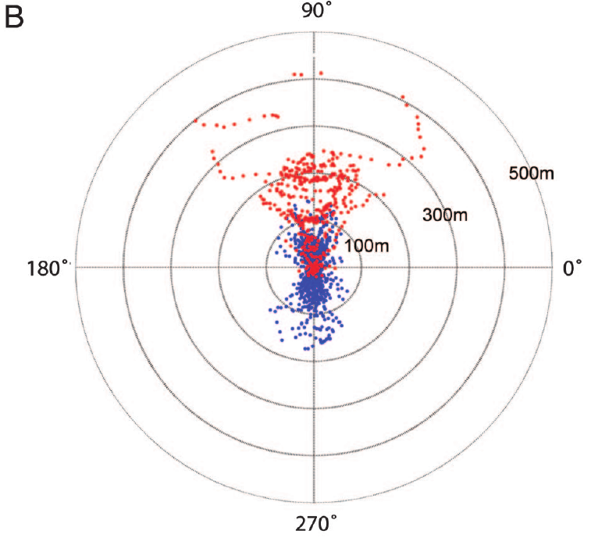
Parallel offsets preserve route shape under clock shift
A parallel offset occurs when a flight retains the shape of a previous route while moving consistently to one side of it. Such a trajectory differs from complete abandonment of the route in favor of a straight compass-directed flight.
After clock shift, some highly familiar pigeons followed paths displaced to the anticlockwise side of their former tracks. The route-relative vectors retained this lateral bias, with distances expressed in metres and reference rings at 100, 300 and 500 m.
The combination is consistent with landmark attraction and compass influence operating together. The tracks cannot distinguish continuous neural integration from rapid switching between sources, and preservation of shape does not prove that the bird recognizes every particular landmark along the route.
Biro et al. (2007), Fig. 2B. Route-relative distances and angles before and after clock shift.
Biro et al. (2007)
11
Notes:
• A **parallel offset** occurs when a flight retains the shape of a previous route while moving consistently to one side of it. Such a trajectory differs from complete abandonment of the route in favor of a straight compass-directed flight.
• After clock shift, some highly familiar pigeons followed paths displaced to the anticlockwise side of their former tracks. The route-relative vectors retained this lateral bias, with distances expressed in metres and reference rings at 100, 300 and 500 m.
• The combination is consistent with landmark attraction and compass influence operating together. The tracks cannot distinguish continuous neural integration from rapid switching between sources, and preservation of shape does not prove that the bird recognizes every particular landmark along the route.
References:
Biro D, Freeman R, Meade J, Roberts S, Guilford T (2007). Pigeons combine compass and landmark guidance in familiar route navigation. Proceedings of the National Academy of Sciences 104(18):7471–7476. https://doi.org/10.1073/pnas.0701575104
Figure: Biro et al. (2007), Fig. 2B. Route-relative distances and angles before and after clock shift.
Figure source: https://doi.org/10.1073/pnas.0701575104

Slide 12
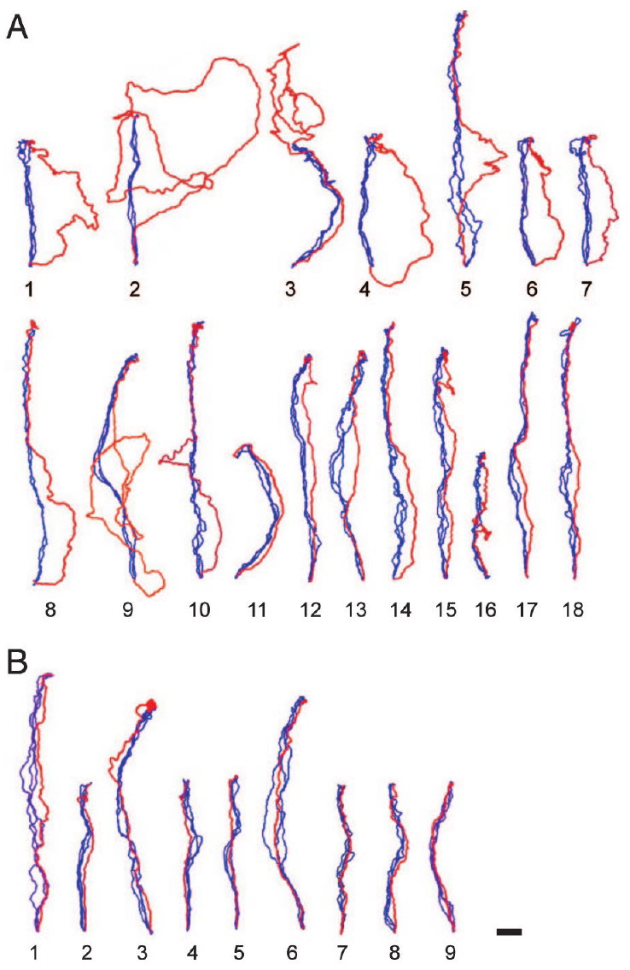
The same manipulation produces different individual routes
Group averages can conceal distinct individual responses to conflicting cues. In Biro and colleagues’ experiment, each highly familiar pigeon’s final training flights were compared with its single clock-shifted test flight, allowing retention and disruption of route shape to be separated.
Some shifted pigeons deviated prominently from the learned corridor, some followed parallel offsets, and others reproduced their earlier route closely. The published tracks were rotated to a common release-to-home orientation and retain a 1 km scale for spatial comparison.
These differences constrain a binary account in which familiarity either eliminates compass influence or leaves it unchanged. They do not identify stable sensory types among pigeons, because an individual response can also depend on route geometry, local visibility and the particular test conditions.
Biro et al. (2007), Fig. 3A–B. Individual homing tracks before and after clock shift.
Biro et al. (2007)
12
Notes:
• Group averages can conceal distinct individual responses to conflicting cues. In Biro and colleagues’ experiment, each highly familiar pigeon’s final training flights were compared with its single clock-shifted test flight, allowing retention and disruption of route shape to be separated.
• Some shifted pigeons deviated prominently from the learned corridor, some followed parallel offsets, and others reproduced their earlier route closely. The published tracks were rotated to a common release-to-home orientation and retain a 1 km scale for spatial comparison.
• These differences constrain a binary account in which familiarity either eliminates compass influence or leaves it unchanged. They do not identify stable sensory types among pigeons, because an individual response can also depend on route geometry, local visibility and the particular test conditions.
References:
Biro D, Freeman R, Meade J, Roberts S, Guilford T (2007). Pigeons combine compass and landmark guidance in familiar route navigation. Proceedings of the National Academy of Sciences 104(18):7471–7476. https://doi.org/10.1073/pnas.0701575104
Figure: Biro et al. (2007), Fig. 3A–B. Individual homing tracks before and after clock shift.
Figure source: https://doi.org/10.1073/pnas.0701575104

Slide 13
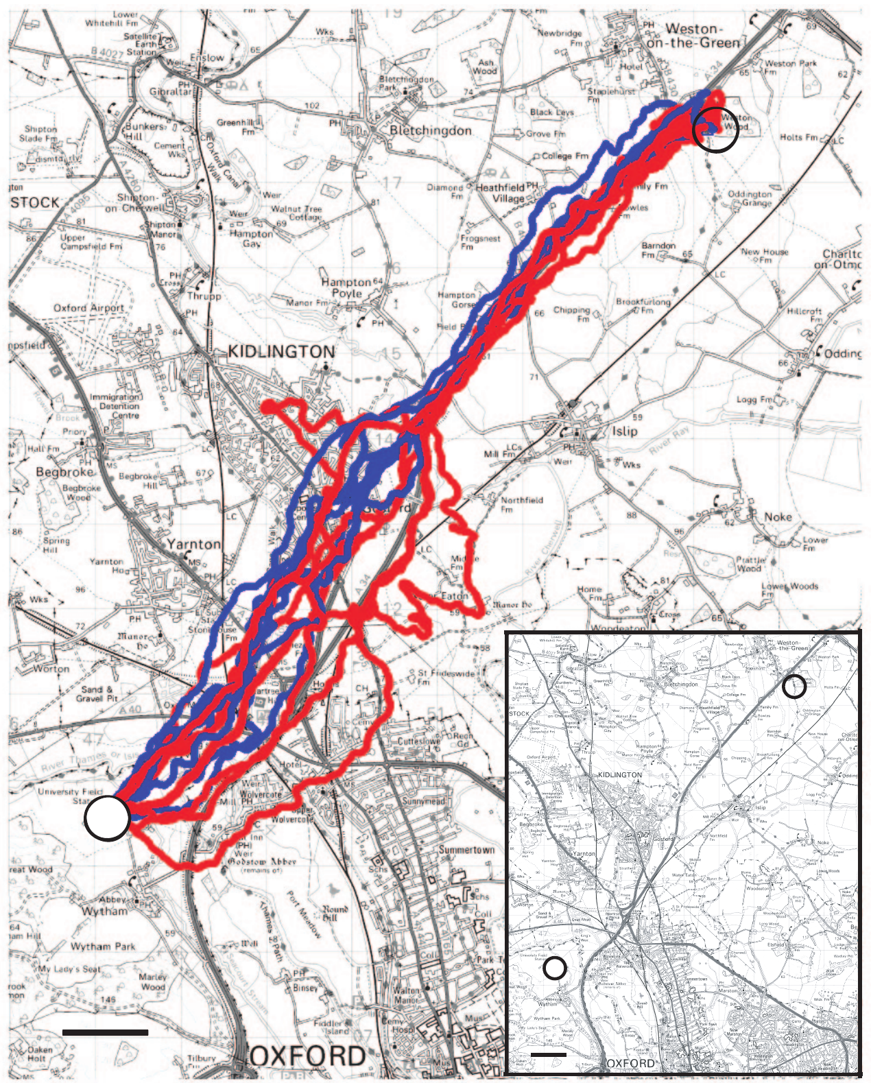
Compass effects can emerge after departure
An initial departure bearing samples only one portion of a homing journey. Landmark and compass influences can change after a bird has already entered a familiar corridor, so absence of an early deviation does not establish absence of compass use.
At Weston Wood, some highly familiar pigeons initially recapitulated their route after clock shift and deviated later. Complete GPS trajectories retained this delayed effect, whereas a bearing taken only as the bird left the release site could miss it. The map retains a 1 km scale.
The timing argues for continued interaction during travel rather than recognition of the release point alone. It does not establish precisely when the internal conflict was detected or which neural process caused the later change in route position.
Biro et al. (2007), Fig. 4. Weston Wood routes before and after clock shift.
Biro et al. (2007)
13
Notes:
• An initial departure bearing samples only one portion of a homing journey. Landmark and compass influences can change after a bird has already entered a familiar corridor, so absence of an early deviation does not establish absence of compass use.
• At Weston Wood, some highly familiar pigeons initially recapitulated their route after clock shift and deviated later. Complete GPS trajectories retained this delayed effect, whereas a bearing taken only as the bird left the release site could miss it. The map retains a 1 km scale.
• The timing argues for continued interaction during travel rather than recognition of the release point alone. It does not establish precisely when the internal conflict was detected or which neural process caused the later change in route position.
References:
Biro D, Freeman R, Meade J, Roberts S, Guilford T (2007). Pigeons combine compass and landmark guidance in familiar route navigation. Proceedings of the National Academy of Sciences 104(18):7471–7476. https://doi.org/10.1073/pnas.0701575104
Figure: Biro et al. (2007), Fig. 4. Weston Wood routes before and after clock shift.
Figure source: https://doi.org/10.1073/pnas.0701575104

Slide 14
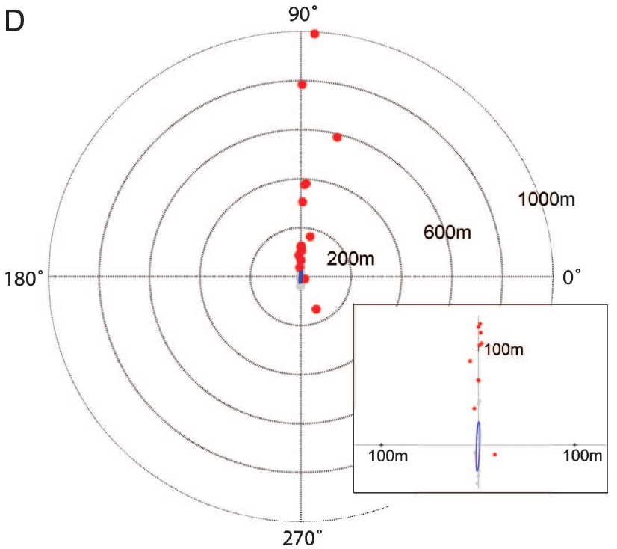
Familiar navigation combines guidance systems
Multimodal navigation uses information from more than one sensory system. In familiar pigeon routes, visual landmarks can constrain movement while a time-dependent compass continues to influence heading. A recognized landscape does not necessarily silence every other directional source.
Biro and colleagues’ 4 h clock shift produced individual displacement vectors ranging from little route change to pronounced lateral offsets. Many highly familiar birds stayed close to previous tracks despite the predicted approximately 90° solar-compass error.
The evidence supports combined guidance while leaving its implementation unresolved. A proposed tolerance around the familiar corridor could permit some compass-driven displacement, but this is an interpretation of trajectories rather than a directly measured neural integration circuit.
Biro et al. (2007), Fig. 2D. Individual route displacement after clock shift.
Biro et al. (2007)
14
Notes:
• **Multimodal navigation** uses information from more than one sensory system. In familiar pigeon routes, visual landmarks can constrain movement while a time-dependent compass continues to influence heading. A recognized landscape does not necessarily silence every other directional source.
• Biro and colleagues’ 4 h clock shift produced individual displacement vectors ranging from little route change to pronounced lateral offsets. Many highly familiar birds stayed close to previous tracks despite the predicted approximately 90° solar-compass error.
• The evidence supports combined guidance while leaving its implementation unresolved. A proposed tolerance around the familiar corridor could permit some compass-driven displacement, but this is an interpretation of trajectories rather than a directly measured neural integration circuit.
References:
Biro D, Freeman R, Meade J, Roberts S, Guilford T (2007). Pigeons combine compass and landmark guidance in familiar route navigation. Proceedings of the National Academy of Sciences 104(18):7471–7476. https://doi.org/10.1073/pnas.0701575104
Figure: Biro et al. (2007), Fig. 2D. Individual route displacement after clock shift.
Figure source: https://doi.org/10.1073/pnas.0701575104

Slide 15
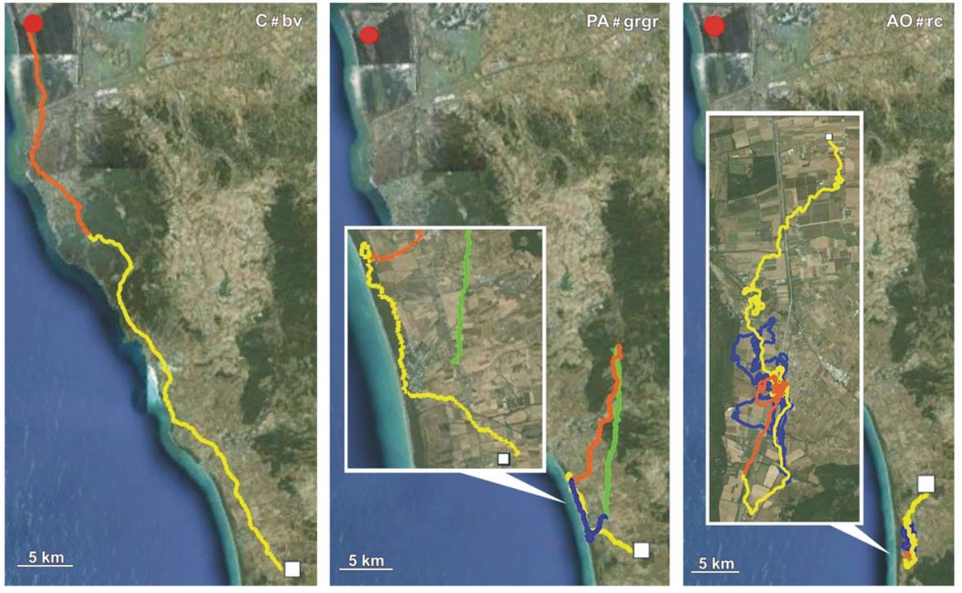
Odor treatments separate information from activation
An olfactory map uses learned environmental odor information to estimate position relative to home. An olfactory activation hypothesis instead proposes that smelling unfamiliar odors enables navigation based on other cues, even when the smells themselves contain no location information.
Gagliardo and colleagues transported pigeons in containers supplied with natural air, charcoal-filtered air or filtered air plus artificial plant odors. Artificial odor puffs were supplied about every 20 min during transport and waiting at the release site.
Natural air and artificial odors therefore both stimulated smell, but only natural air retained the geographical odor mixture. Comparing subsequent tracks tested whether sensory activation alone was sufficient under this preparation; it did not identify which environmental chemicals conveyed usable location information.
Gagliardo et al. (2011), Fig. 1. Homing tracks after natural air, filtered air or artificial odors.
Gagliardo et al. (2011)
15
Notes:
• An **olfactory map** uses learned environmental odor information to estimate position relative to home. An **olfactory activation hypothesis** instead proposes that smelling unfamiliar odors enables navigation based on other cues, even when the smells themselves contain no location information.
• Gagliardo and colleagues transported pigeons in containers supplied with natural air, charcoal-filtered air or filtered air plus artificial plant odors. Artificial odor puffs were supplied about every 20 min during transport and waiting at the release site.
• Natural air and artificial odors therefore both stimulated smell, but only natural air retained the geographical odor mixture. Comparing subsequent tracks tested whether sensory activation alone was sufficient under this preparation; it did not identify which environmental chemicals conveyed usable location information.
References:
Gagliardo A, Ioalè P, Filannino C, Wikelski M (2011). Homing pigeons only navigate in air with intact environmental odours: a test of the olfactory activation hypothesis with GPS data loggers. PLOS ONE 6(8):e22385. https://doi.org/10.1371/journal.pone.0022385
Figure: Gagliardo et al. (2011), Fig. 1. Homing tracks after natural air, filtered air or artificial odors.
Figure source: https://doi.org/10.1371/journal.pone.0022385

Slide 16
Temporary anosmia restricts access to new flight odors
Anosmia is loss of the ability to smell. Gagliardo and colleagues anesthetized the olfactory mucosa, the nasal sensory tissue that detects odors, with Xylocaine immediately before release. This treatment was applied to all three air-exposure groups.
Birds had already experienced natural air, filtered air or artificial odors during transport and before takeoff. Release occurred at sites 53 km and 61 km from home. The common nasal treatment reduced new odor sampling during early flight while preserving differences in prior exposure.
The design concentrates the comparison on information acquired before release. Because local anesthesia wears off, later flight cannot be treated as permanently odor-free; a delayed homeward correction may follow recovery of smell rather than accurate navigation during the initial treatment period.
Gagliardo et al. (2011), Fig. 1. Homing tracks after natural air, filtered air or artificial odors.
Gagliardo et al. (2011)
16
Notes:
• **Anosmia** is loss of the ability to smell. Gagliardo and colleagues anesthetized the olfactory mucosa, the nasal sensory tissue that detects odors, with Xylocaine immediately before release. This treatment was applied to all three air-exposure groups.
• Birds had already experienced natural air, filtered air or artificial odors during transport and before takeoff. Release occurred at sites 53 km and 61 km from home. The common nasal treatment reduced new odor sampling during early flight while preserving differences in prior exposure.
• The design concentrates the comparison on information acquired before release. Because local anesthesia wears off, later flight cannot be treated as permanently odor-free; a delayed homeward correction may follow recovery of smell rather than accurate navigation during the initial treatment period.
References:
Gagliardo A, Ioalè P, Filannino C, Wikelski M (2011). Homing pigeons only navigate in air with intact environmental odours: a test of the olfactory activation hypothesis with GPS data loggers. PLOS ONE 6(8):e22385. https://doi.org/10.1371/journal.pone.0022385
Figure: Gagliardo et al. (2011), Fig. 1. Homing tracks after natural air, filtered air or artificial odors.
Figure source: https://doi.org/10.1371/journal.pone.0022385

Slide 17
Natural environmental odors support early homing
A useful odor treatment must improve navigation rather than merely induce movement. Gagliardo and colleagues recorded GPS tracks at 1 Hz after releasing pigeons exposed to different air conditions, with the same temporary nasal anesthesia applied across groups.
Control birds exposed to intact environmental odors showed better homeward movement during the first hour. Filtered-air and artificial-odor birds displayed poorer initial navigation, despite artificial odors providing repeated olfactory stimulation. Tracks retain a 5 km scale and the time sequence of movement.
The outcome supports a specific navigational contribution of environmental odors under these conditions. It does not prove that olfaction always dominates every pigeon journey, especially in familiar terrain where recognized landmarks can supply a different form of guidance.
Gagliardo et al. (2011), Fig. 1. Homing tracks after natural air, filtered air or artificial odors.
Gagliardo et al. (2011)
17
Notes:
• A useful odor treatment must improve navigation rather than merely induce movement. Gagliardo and colleagues recorded GPS tracks at 1 Hz after releasing pigeons exposed to different air conditions, with the same temporary nasal anesthesia applied across groups.
• Control birds exposed to intact environmental odors showed better homeward movement during the first hour. Filtered-air and artificial-odor birds displayed poorer initial navigation, despite artificial odors providing repeated olfactory stimulation. Tracks retain a 5 km scale and the time sequence of movement.
• The outcome supports a specific navigational contribution of environmental odors under these conditions. It does not prove that olfaction always dominates every pigeon journey, especially in familiar terrain where recognized landmarks can supply a different form of guidance.
References:
Gagliardo A, Ioalè P, Filannino C, Wikelski M (2011). Homing pigeons only navigate in air with intact environmental odours: a test of the olfactory activation hypothesis with GPS data loggers. PLOS ONE 6(8):e22385. https://doi.org/10.1371/journal.pone.0022385
Figure: Gagliardo et al. (2011), Fig. 1. Homing tracks after natural air, filtered air or artificial odors.
Figure source: https://doi.org/10.1371/journal.pone.0022385

Slide 18
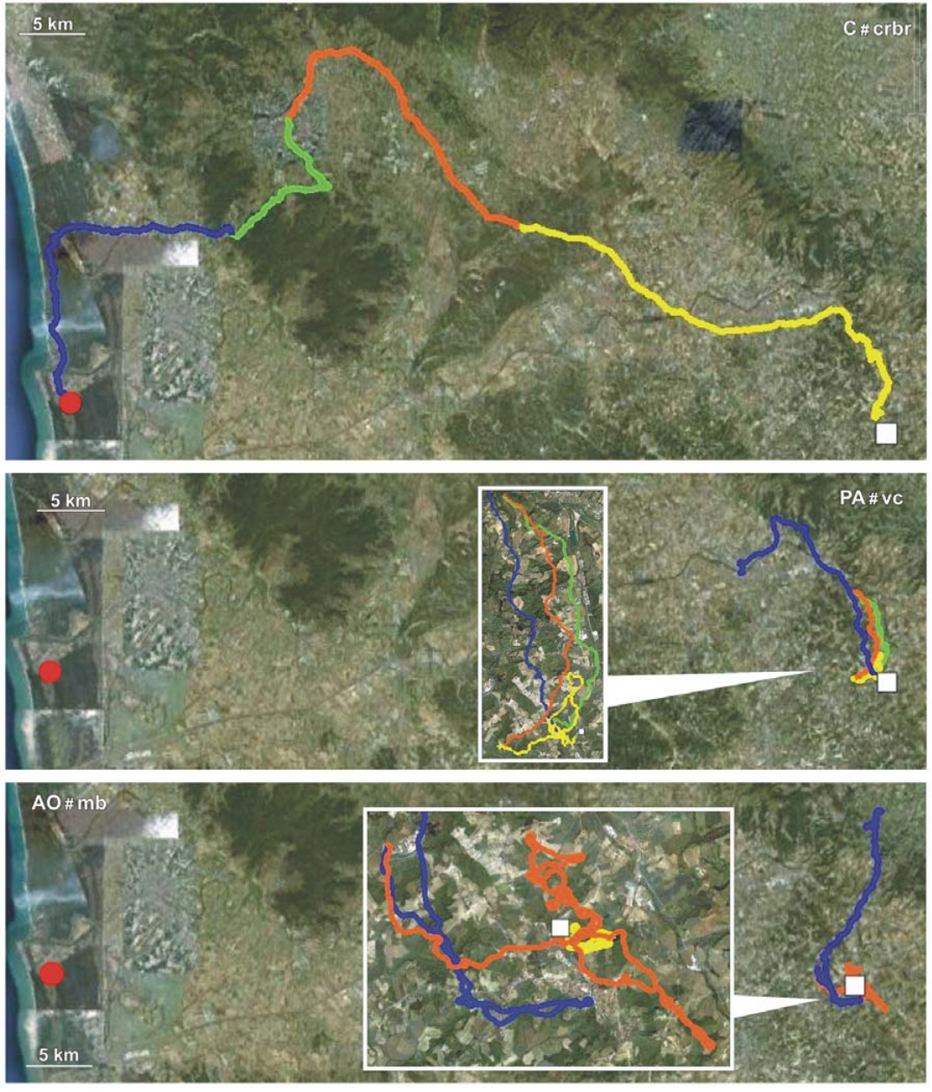
Artificial odors do not restore navigational information
Artificial odors can stimulate olfactory receptors without reproducing the natural relationship between odor mixtures and geographical position. In Gagliardo and colleagues’ experiment, plant odors were delivered in filtered air during transport and the pre-release waiting period.
The artificial-odor group did not match controls exposed to environmental air at either the 53 km or 61 km release site. Its GPS tracks often remained tortuous or near release rather than progressing reliably homeward during the first hour.
This failure contradicts a simple activation-only prediction for this preparation. It does not demonstrate that unfamiliar smells can never modulate navigation, because stimulation strength, odor history and the type of navigational task can influence how an olfactory treatment affects behavior.
Gagliardo et al. (2011), Fig. 2. Contrasting routes after the three odor treatments.
Gagliardo et al. (2011)
18
Notes:
• Artificial odors can stimulate olfactory receptors without reproducing the natural relationship between odor mixtures and geographical position. In Gagliardo and colleagues’ experiment, plant odors were delivered in filtered air during transport and the pre-release waiting period.
• The artificial-odor group did not match controls exposed to environmental air at either the 53 km or 61 km release site. Its GPS tracks often remained tortuous or near release rather than progressing reliably homeward during the first hour.
• This failure contradicts a simple activation-only prediction for this preparation. It does not demonstrate that unfamiliar smells can never modulate navigation, because stimulation strength, odor history and the type of navigational task can influence how an olfactory treatment affects behavior.
References:
Gagliardo A, Ioalè P, Filannino C, Wikelski M (2011). Homing pigeons only navigate in air with intact environmental odours: a test of the olfactory activation hypothesis with GPS data loggers. PLOS ONE 6(8):e22385. https://doi.org/10.1371/journal.pone.0022385
Figure: Gagliardo et al. (2011), Fig. 2. Contrasting routes after the three odor treatments.
Figure source: https://doi.org/10.1371/journal.pone.0022385

Slide 19
Route tortuosity separates travel from homeward progress
Tortuosity describes how winding a path is relative to its net displacement. A pigeon can remain actively flying while making little progress toward home. Total movement and navigational success must therefore be distinguished when interpreting an odor manipulation.
Gagliardo and colleagues analyzed first-hour flight after releases 53 km and 61 km from the loft. Artificial-odor birds had more tortuous paths and reduced homeward progress compared with controls, even though the comparison did not reveal a consistent difference in time spent flying.
The impairment concerns guidance rather than a simple inability to move. GPS does not reveal the bird’s motivation directly, but the combination of movement and poor progress makes generalized inactivity insufficient as the sole explanation of the olfactory-treatment effect.
Gagliardo et al. (2011), Fig. 2. Contrasting routes after the three odor treatments.
Gagliardo et al. (2011)
19
Notes:
• **Tortuosity** describes how winding a path is relative to its net displacement. A pigeon can remain actively flying while making little progress toward home. Total movement and navigational success must therefore be distinguished when interpreting an odor manipulation.
• Gagliardo and colleagues analyzed first-hour flight after releases 53 km and 61 km from the loft. Artificial-odor birds had more tortuous paths and reduced homeward progress compared with controls, even though the comparison did not reveal a consistent difference in time spent flying.
• The impairment concerns guidance rather than a simple inability to move. GPS does not reveal the bird’s motivation directly, but the combination of movement and poor progress makes generalized inactivity insufficient as the sole explanation of the olfactory-treatment effect.
References:
Gagliardo A, Ioalè P, Filannino C, Wikelski M (2011). Homing pigeons only navigate in air with intact environmental odours: a test of the olfactory activation hypothesis with GPS data loggers. PLOS ONE 6(8):e22385. https://doi.org/10.1371/journal.pone.0022385
Figure: Gagliardo et al. (2011), Fig. 2. Contrasting routes after the three odor treatments.
Figure source: https://doi.org/10.1371/journal.pone.0022385

Slide 20
Distance remaining provides a separate homing measure
The distance still separating a bird from its loft measures progress toward the goal independently of total path length. A wandering bird may accumulate a long flight without substantially decreasing this distance, whereas a directed flight reduces it steadily.
One hour after the 53 km Bolgheri release, median distances from home were 29.9 km for controls, 43.8 km for filtered-air birds and 53.5 km for artificial-odor birds. Every group received the same immediate pre-release nasal anesthesia.
The values support stronger early homeward progress after exposure to environmental air. They are condition-specific behavioral outcomes rather than a direct measure of spatial-memory precision; stopping, circling and route selection can all contribute to the remaining distance.
Gagliardo et al. (2011), Fig. 1. Homing tracks after natural air, filtered air or artificial odors.
Gagliardo et al. (2011)
20
Notes:
• The distance still separating a bird from its loft measures progress toward the goal independently of total path length. A wandering bird may accumulate a long flight without substantially decreasing this distance, whereas a directed flight reduces it steadily.
• One hour after the 53 km Bolgheri release, median distances from home were 29.9 km for controls, 43.8 km for filtered-air birds and 53.5 km for artificial-odor birds. Every group received the same immediate pre-release nasal anesthesia.
• The values support stronger early homeward progress after exposure to environmental air. They are condition-specific behavioral outcomes rather than a direct measure of spatial-memory precision; stopping, circling and route selection can all contribute to the remaining distance.
References:
Gagliardo A, Ioalè P, Filannino C, Wikelski M (2011). Homing pigeons only navigate in air with intact environmental odours: a test of the olfactory activation hypothesis with GPS data loggers. PLOS ONE 6(8):e22385. https://doi.org/10.1371/journal.pone.0022385
Figure: Gagliardo et al. (2011), Fig. 1. Homing tracks after natural air, filtered air or artificial odors.
Figure source: https://doi.org/10.1371/journal.pone.0022385

Slide 21
Long tracks reveal recovery and persistent impairment
Temporal separation matters when a manipulation decays during a journey. Gagliardo and colleagues distinguished the first, second and third hours of GPS tracking rather than assuming nasal anesthesia remained equally effective throughout the experiment.
Some filtered-air pigeons improved their homeward orientation after the earliest period, consistent with access to natural odors after recovery. Artificial-odor pigeons remained impaired in broader portions of the tracks. Published paths preserve the successive hours and a 5 km scale.
Later improvement cannot retrospectively establish intact navigation during the first hour. Conversely, a late return to the loft does not make the initial treatment ineffective; complete trajectories separate the immediate guidance deficit from subsequent compensation, recovery and searching.
Gagliardo et al. (2011), Fig. 2. Contrasting routes after the three odor treatments.
Gagliardo et al. (2011)
21
Notes:
• Temporal separation matters when a manipulation decays during a journey. Gagliardo and colleagues distinguished the first, second and third hours of GPS tracking rather than assuming nasal anesthesia remained equally effective throughout the experiment.
• Some filtered-air pigeons improved their homeward orientation after the earliest period, consistent with access to natural odors after recovery. Artificial-odor pigeons remained impaired in broader portions of the tracks. Published paths preserve the successive hours and a 5 km scale.
• Later improvement cannot retrospectively establish intact navigation during the first hour. Conversely, a late return to the loft does not make the initial treatment ineffective; complete trajectories separate the immediate guidance deficit from subsequent compensation, recovery and searching.
References:
Gagliardo A, Ioalè P, Filannino C, Wikelski M (2011). Homing pigeons only navigate in air with intact environmental odours: a test of the olfactory activation hypothesis with GPS data loggers. PLOS ONE 6(8):e22385. https://doi.org/10.1371/journal.pone.0022385
Figure: Gagliardo et al. (2011), Fig. 2. Contrasting routes after the three odor treatments.
Figure source: https://doi.org/10.1371/journal.pone.0022385

Slide 22
Short departures can conceal later navigation failure
A vanishing bearing is the direction recorded when a released bird disappears from direct observation. It measures an early departure, whereas a complete GPS track includes later circling, stopping, course correction and progress toward home.
Gagliardo and colleagues found that bearings inferred from early track sections did not fully capture the deficits evident over the first hour and beyond. At the 53 km release, artificial-odor birds could depart without subsequently making substantial homeward progress.
The discrepancy limits conclusions drawn from departure alone. A compass can support an initial direction without an adequate location estimate, while an apparently poor early direction may later be corrected; neither possibility can be resolved from a single brief observation.
Gagliardo et al. (2011), Fig. 2. Contrasting routes after the three odor treatments.
Gagliardo et al. (2011)
22
Notes:
• A **vanishing bearing** is the direction recorded when a released bird disappears from direct observation. It measures an early departure, whereas a complete GPS track includes later circling, stopping, course correction and progress toward home.
• Gagliardo and colleagues found that bearings inferred from early track sections did not fully capture the deficits evident over the first hour and beyond. At the 53 km release, artificial-odor birds could depart without subsequently making substantial homeward progress.
• The discrepancy limits conclusions drawn from departure alone. A compass can support an initial direction without an adequate location estimate, while an apparently poor early direction may later be corrected; neither possibility can be resolved from a single brief observation.
References:
Gagliardo A, Ioalè P, Filannino C, Wikelski M (2011). Homing pigeons only navigate in air with intact environmental odours: a test of the olfactory activation hypothesis with GPS data loggers. PLOS ONE 6(8):e22385. https://doi.org/10.1371/journal.pone.0022385
Figure: Gagliardo et al. (2011), Fig. 2. Contrasting routes after the three odor treatments.
Figure source: https://doi.org/10.1371/journal.pone.0022385

Slide 23
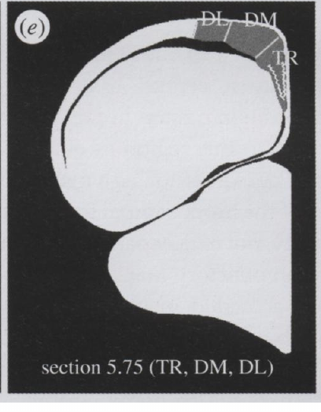
Odor experiments test distinct behavioral preparations
Path integration estimates displacement using information gathered during movement. It differs from a learned environmental map. Jorge and colleagues studied young pigeons 7–8 weeks old during displacement or simulated displacement, whereas Gagliardo and colleagues assessed complete homing tracks after odor treatments.
Jorge and colleagues compared natural odors, artificial odors and filtered air, including birds exposed at the home loft rather than transported. They measured activity-related labeling in the hippocampal formation, a forebrain region associated with spatial processing.
The neural and behavioral studies address different endpoints and developmental conditions. Odor-dependent brain activation can occur without establishing that artificial odors provide geographical information or restore the first-hour homing performance measured in the other preparation.
Jorge et al. (2014), Fig. 1e. Sampled subdivisions of the pigeon hippocampal formation.
Jorge et al. (2014); Gagliardo et al. (2011)
23
Notes:
• **Path integration** estimates displacement using information gathered during movement. It differs from a learned environmental map. Jorge and colleagues studied young pigeons 7–8 weeks old during displacement or simulated displacement, whereas Gagliardo and colleagues assessed complete homing tracks after odor treatments.
• Jorge and colleagues compared natural odors, artificial odors and filtered air, including birds exposed at the home loft rather than transported. They measured activity-related labeling in the **hippocampal formation**, a forebrain region associated with spatial processing.
• The neural and behavioral studies address different endpoints and developmental conditions. Odor-dependent brain activation can occur without establishing that artificial odors provide geographical information or restore the first-hour homing performance measured in the other preparation.
References:
Jorge PE, Phillips JB, Gonçalves A, Marques PAM, Němec P (2014). Odours stimulate neuronal activity in the dorsolateral area of the hippocampal formation during path integration. Proceedings of the Royal Society B 281(1783):20140025. https://doi.org/10.1098/rspb.2014.0025
Gagliardo A, Ioalè P, Filannino C, Wikelski M (2011). Homing pigeons only navigate in air with intact environmental odours: a test of the olfactory activation hypothesis with GPS data loggers. PLOS ONE 6(8):e22385. https://doi.org/10.1371/journal.pone.0022385
Figure: Jorge et al. (2014), Fig. 1e. Sampled subdivisions of the pigeon hippocampal formation.
Figure source: https://doi.org/10.1098/rspb.2014.0025

Slide 24
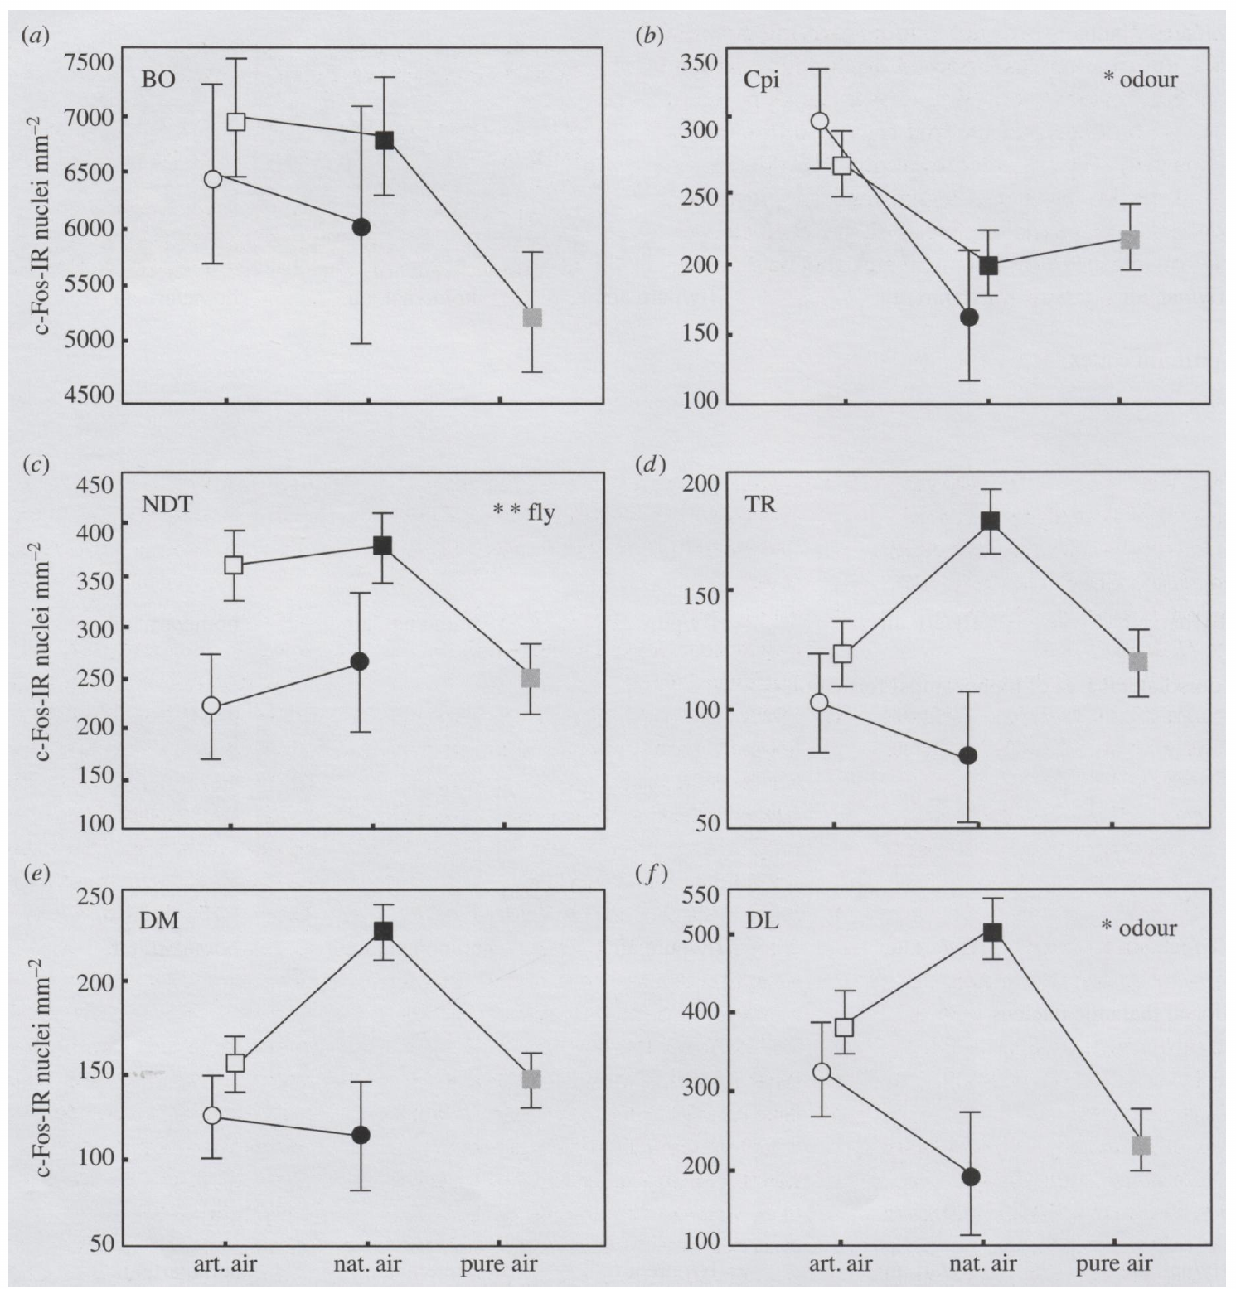
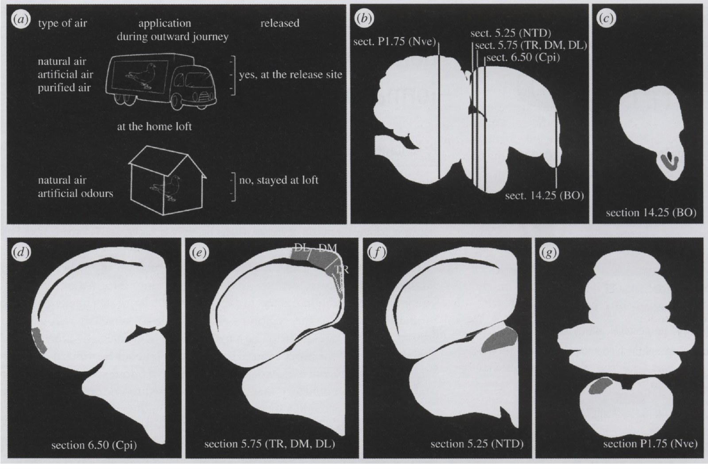
c-Fos labeling measures accumulated neuronal activation
c-Fos is an activity-related gene product whose expression can mark recent neuronal activation. Immunoreactive nuclei are cells detected by antibody labeling. Their density provides a regional index accumulated over time, rather than an instantaneous record of action potentials.
Jorge and colleagues collected pigeon brains 1–2 h after odor manipulation and compared c-Fos-labeled nuclei per square millimetre. The sampled regions included the hippocampal formation, olfactory bulb and piriform cortex, with separate odor and flight conditions.
The measurement links exposure history to a regional response, but does not identify a neuron encoding home direction. Expression depends on cellular signaling and timing; these data do not specify a neurotransmitter, receptor subtype or ion channel responsible for the navigation-related effect.
Jorge et al. (2014), Fig. 1a–g. Treatment conditions and sampled forebrain and vestibular anatomy.
Jorge et al. (2014), Fig. 3a–f. Regional c-Fos activation after odor and flight treatments.
Jorge et al. (2014)
24
Notes:
• **c-Fos** is an activity-related gene product whose expression can mark recent neuronal activation. Immunoreactive nuclei are cells detected by antibody labeling. Their density provides a regional index accumulated over time, rather than an instantaneous record of action potentials.
• Jorge and colleagues collected pigeon brains 1–2 h after odor manipulation and compared c-Fos-labeled nuclei per square millimetre. The sampled regions included the hippocampal formation, olfactory bulb and piriform cortex, with separate odor and flight conditions.
• The measurement links exposure history to a regional response, but does not identify a neuron encoding home direction. Expression depends on cellular signaling and timing; these data do not specify a neurotransmitter, receptor subtype or ion channel responsible for the navigation-related effect.
References:
Jorge PE, Phillips JB, Gonçalves A, Marques PAM, Němec P (2014). Odours stimulate neuronal activity in the dorsolateral area of the hippocampal formation during path integration. Proceedings of the Royal Society B 281(1783):20140025. https://doi.org/10.1098/rspb.2014.0025
Figure: Jorge et al. (2014), Fig. 3a–f. Regional c-Fos activation after odor and flight treatments.
Figure source: https://doi.org/10.1098/rspb.2014.0025
Figure: Jorge et al. (2014), Fig. 1a–g. Treatment conditions and sampled forebrain and vestibular anatomy.
Figure source: https://doi.org/10.1098/rspb.2014.0025

Slide 25
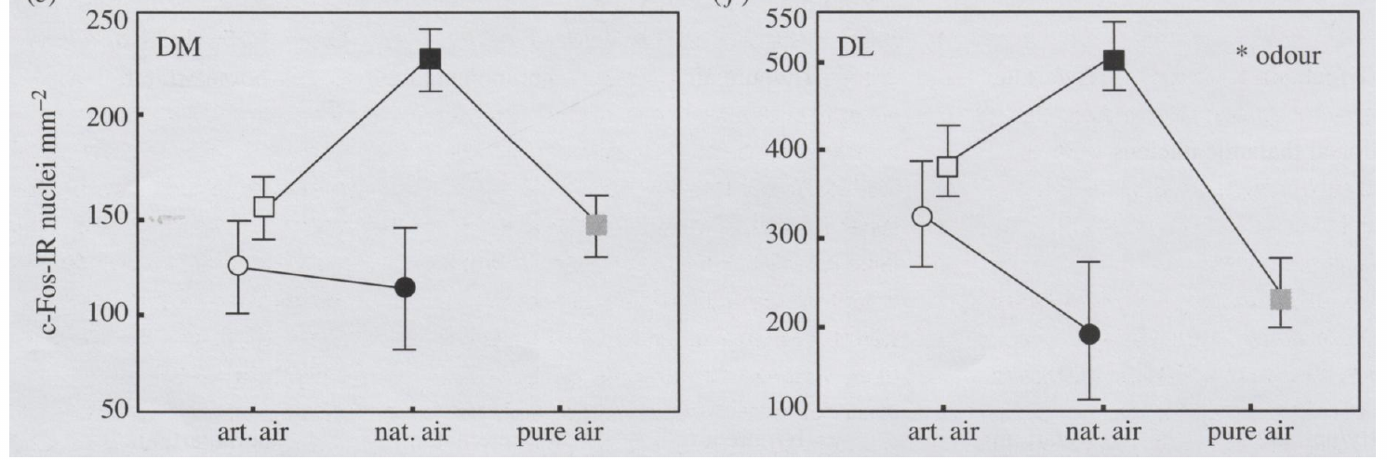
Non-home odors activate dorsolateral hippocampal tissue
The dorsolateral hippocampal area is one subdivision of the pigeon hippocampal formation, distinct from its dorsomedial and triangular subdivisions. Jorge and colleagues measured c-Fos labeling separately in these regions to avoid treating the forebrain response as spatially uniform.
Natural odors during displacement and unfamiliar artificial odors increased dorsolateral activation relative to filtered air. Artificial odor exposure at the home loft also produced activation comparable to exposure during displacement. The response was quantified as labeled nuclei per square millimetre.
This pattern supports an effect of non-home odor exposure rather than a response uniquely dependent on geographical displacement. The authors proposed activation of navigation-related processing, but the labeling does not establish that the dorsolateral tissue computes a complete location estimate.
Jorge et al. (2014), Fig. 3e–f. Dorsomedial and dorsolateral hippocampal activation.
Jorge et al. (2014), Fig. 1a–g. Treatment conditions and sampled forebrain and vestibular anatomy.
Jorge et al. (2014)
25
Notes:
• The **dorsolateral hippocampal area** is one subdivision of the pigeon hippocampal formation, distinct from its dorsomedial and triangular subdivisions. Jorge and colleagues measured c-Fos labeling separately in these regions to avoid treating the forebrain response as spatially uniform.
• Natural odors during displacement and unfamiliar artificial odors increased dorsolateral activation relative to filtered air. Artificial odor exposure at the home loft also produced activation comparable to exposure during displacement. The response was quantified as labeled nuclei per square millimetre.
• This pattern supports an effect of non-home odor exposure rather than a response uniquely dependent on geographical displacement. The authors proposed activation of navigation-related processing, but the labeling does not establish that the dorsolateral tissue computes a complete location estimate.
References:
Jorge PE, Phillips JB, Gonçalves A, Marques PAM, Němec P (2014). Odours stimulate neuronal activity in the dorsolateral area of the hippocampal formation during path integration. Proceedings of the Royal Society B 281(1783):20140025. https://doi.org/10.1098/rspb.2014.0025
Figure: Jorge et al. (2014), Fig. 3e–f. Dorsomedial and dorsolateral hippocampal activation.
Figure source: https://doi.org/10.1098/rspb.2014.0025
Figure: Jorge et al. (2014), Fig. 1a–g. Treatment conditions and sampled forebrain and vestibular anatomy.
Figure source: https://doi.org/10.1098/rspb.2014.0025

Slide 26
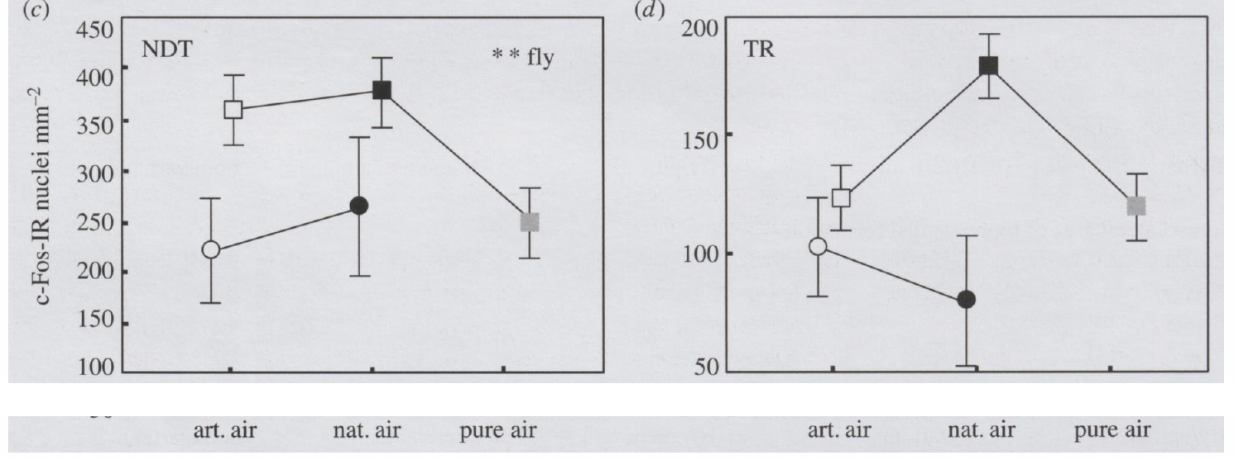
Flight and odor exposure have region-specific effects
The dorsal thalamic nucleus is a brain region receiving inputs relevant to sensory integration. Jorge and colleagues compared this region with subdivisions of the hippocampal formation, using displacement and simulated displacement to separate movement history from odor treatment.
Dorsal thalamic c-Fos labeling increased in birds that experienced displacement and homing flight. Hippocampal subdivisions did not all follow the same response pattern, and the dorsolateral response was particularly associated with odor exposure. Activity was measured as nuclei per square millimetre.
Regional differences oppose an account based solely on uniform whole-brain arousal. Nevertheless, activity-related labeling cannot establish the direction of information flow or prove a causal connection between thalamic activation and the hippocampal response.
Jorge et al. (2014), Fig. 3c–d. Dorsal thalamic and triangular hippocampal activation.
Jorge et al. (2014), Fig. 1a–g. Treatment conditions and sampled forebrain and vestibular anatomy.
Jorge et al. (2014)
26
Notes:
• The **dorsal thalamic nucleus** is a brain region receiving inputs relevant to sensory integration. Jorge and colleagues compared this region with subdivisions of the hippocampal formation, using displacement and simulated displacement to separate movement history from odor treatment.
• Dorsal thalamic c-Fos labeling increased in birds that experienced displacement and homing flight. Hippocampal subdivisions did not all follow the same response pattern, and the dorsolateral response was particularly associated with odor exposure. Activity was measured as nuclei per square millimetre.
• Regional differences oppose an account based solely on uniform whole-brain arousal. Nevertheless, activity-related labeling cannot establish the direction of information flow or prove a causal connection between thalamic activation and the hippocampal response.
References:
Jorge PE, Phillips JB, Gonçalves A, Marques PAM, Němec P (2014). Odours stimulate neuronal activity in the dorsolateral area of the hippocampal formation during path integration. Proceedings of the Royal Society B 281(1783):20140025. https://doi.org/10.1098/rspb.2014.0025
Figure: Jorge et al. (2014), Fig. 3c–d. Dorsal thalamic and triangular hippocampal activation.
Figure source: https://doi.org/10.1098/rspb.2014.0025
Figure: Jorge et al. (2014), Fig. 1a–g. Treatment conditions and sampled forebrain and vestibular anatomy.
Figure source: https://doi.org/10.1098/rspb.2014.0025

Slide 27
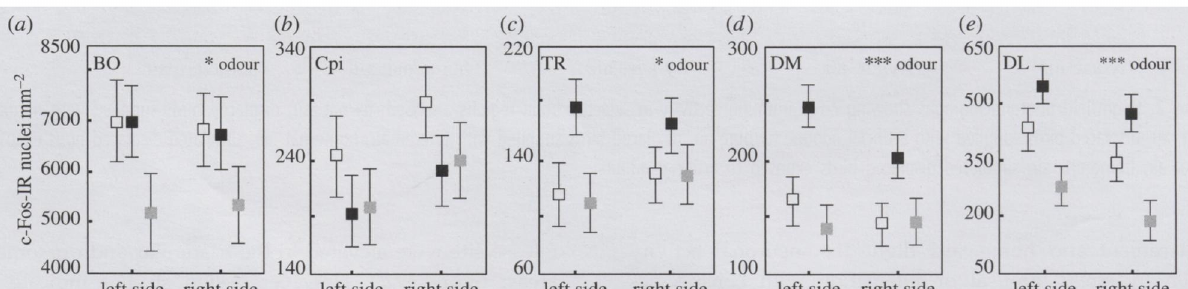
Lateralized activity does not prove a unique odor map
Lateralization is a difference in function or activity between the left and right sides of the brain. Jorge and colleagues counted c-Fos-labeled nuclei separately in each hemisphere after odor exposure and homing rather than pooling bilateral tissue.
Olfactory treatments affected the hemispheric pattern in the olfactory bulb, piriform cortex and hippocampal subdivisions. Dorsolateral and dorsomedial hippocampal responses were consistent with a greater contribution of left-sided tissue to aspects of processing under the tested conditions.
These density measurements, expressed per square millimetre, support anatomical specificity. They do not prove that one hemisphere contains the olfactory map or that odor activation alone restores successful navigation; regional expression remains an indirect endpoint with multiple possible functional interpretations.
Jorge et al. (2014), Fig. 4a–e. Left and right forebrain activation in birds that flew home.
Jorge et al. (2014), Fig. 1a–g. Treatment conditions and sampled forebrain and vestibular anatomy.
Jorge et al. (2014)
27
Notes:
• **Lateralization** is a difference in function or activity between the left and right sides of the brain. Jorge and colleagues counted c-Fos-labeled nuclei separately in each hemisphere after odor exposure and homing rather than pooling bilateral tissue.
• Olfactory treatments affected the hemispheric pattern in the olfactory bulb, piriform cortex and hippocampal subdivisions. Dorsolateral and dorsomedial hippocampal responses were consistent with a greater contribution of left-sided tissue to aspects of processing under the tested conditions.
• These density measurements, expressed per square millimetre, support anatomical specificity. They do not prove that one hemisphere contains the olfactory map or that odor activation alone restores successful navigation; regional expression remains an indirect endpoint with multiple possible functional interpretations.
References:
Jorge PE, Phillips JB, Gonçalves A, Marques PAM, Němec P (2014). Odours stimulate neuronal activity in the dorsolateral area of the hippocampal formation during path integration. Proceedings of the Royal Society B 281(1783):20140025. https://doi.org/10.1098/rspb.2014.0025
Figure: Jorge et al. (2014), Fig. 4a–e. Left and right forebrain activation in birds that flew home.
Figure source: https://doi.org/10.1098/rspb.2014.0025
Figure: Jorge et al. (2014), Fig. 1a–g. Treatment conditions and sampled forebrain and vestibular anatomy.
Figure source: https://doi.org/10.1098/rspb.2014.0025

Slide 28
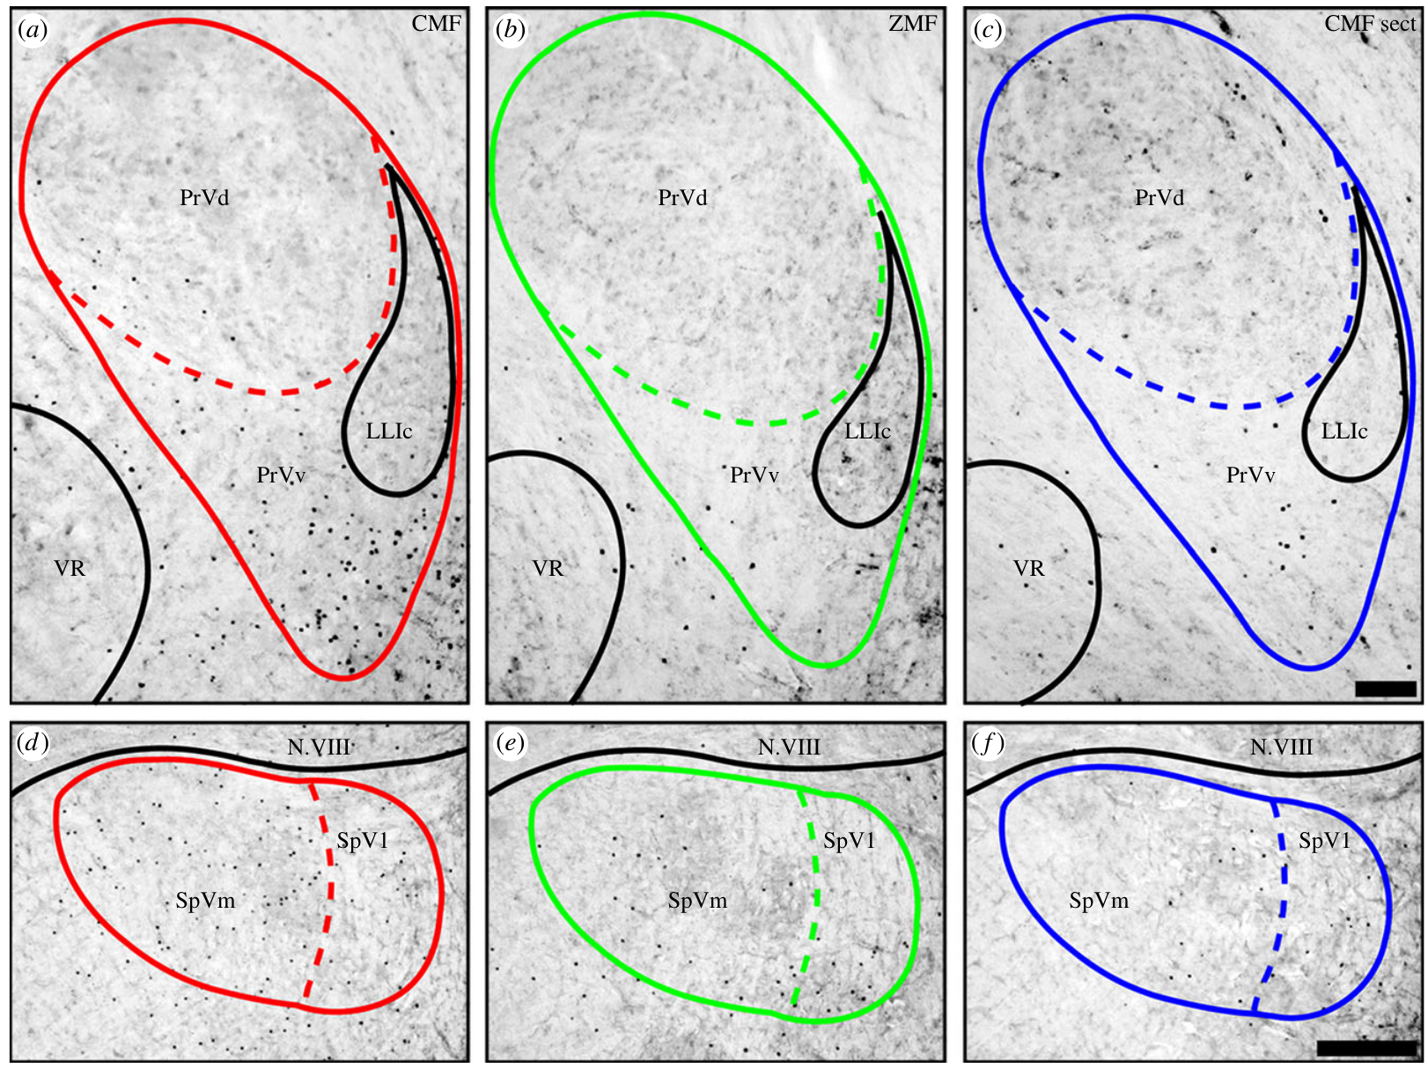
Magnetic stimulation recruits trigeminal brain regions
The trigeminal nerve carries sensory information from the head. Its ophthalmic branch, designated V1, projects to brainstem trigeminal nuclei. Lefeldt and colleagues asked whether changing magnetic fields activated these receiving regions in pigeons.
Birds experienced a constantly changing magnetic field, a compensated zero field, or the changing field after bilateral V1 section. Exposure lasted 3 h. ZENK, an activity-related gene product, was detected in the principal and spinal trigeminal nuclei.
Changing-field exposure increased regional labeling when V1 was intact, while field removal and nerve section reduced it. The evidence links magnetic stimulation to a peripheral afferent pathway, but does not identify the receptor cell or establish successful magnetic navigation in the arena.
Lefeldt et al. (2014), Fig. 1a–f. ZENK labeling after magnetic stimulation and nerve section.
Lefeldt et al. (2014)
28
Notes:
• The **trigeminal nerve** carries sensory information from the head. Its **ophthalmic branch**, designated V1, projects to brainstem trigeminal nuclei. Lefeldt and colleagues asked whether changing magnetic fields activated these receiving regions in pigeons.
• Birds experienced a constantly changing magnetic field, a compensated zero field, or the changing field after bilateral V1 section. Exposure lasted 3 h. **ZENK**, an activity-related gene product, was detected in the principal and spinal trigeminal nuclei.
• Changing-field exposure increased regional labeling when V1 was intact, while field removal and nerve section reduced it. The evidence links magnetic stimulation to a peripheral afferent pathway, but does not identify the receptor cell or establish successful magnetic navigation in the arena.
References:
Lefeldt N, Heyers D, Schneider NL, Engels S, Elbers D, Mouritsen H (2014). Magnetic field-driven induction of ZENK in the trigeminal system of pigeons (Columba livia). Journal of the Royal Society Interface 11(100):20140777. https://doi.org/10.1098/rsif.2014.0777
Figure: Lefeldt et al. (2014), Fig. 1a–f. ZENK labeling after magnetic stimulation and nerve section.
Figure source: https://doi.org/10.1098/rsif.2014.0777

Slide 29
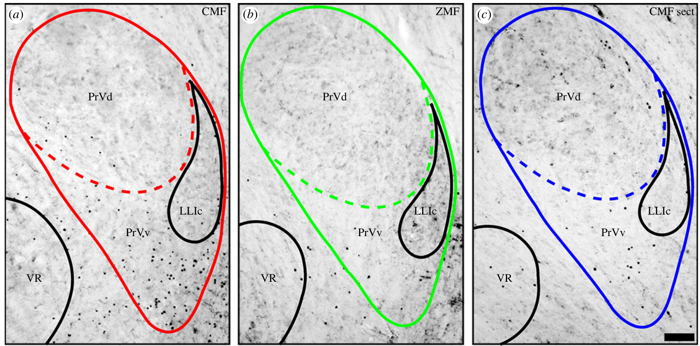
The principal trigeminal response is anatomically selective
The principal sensory nucleus of the trigeminal nerve, abbreviated PrV, receives ascending sensory input from the head. Its ventral region, PrVv, can be distinguished from the dorsal region using the brainstem anatomy preserved in the source sections.
After 3 h of changing magnetic fields, Lefeldt and colleagues found ZENK labeling concentrated in a crescent-shaped ventral region. Zero-field exposure and bilateral V1 section reduced the response. The original micrographs retain a 100 µm scale bar.
Spatial concentration is consistent with a specific receiving region rather than uniform activation of every PrV neuron. ZENK labeling does not measure the firing rate of those cells, establish their magnetic tuning or identify whether the input encodes direction, intensity or another field property.
Lefeldt et al. (2014), Fig. 1a–c. Principal trigeminal nucleus activation across treatments.
Lefeldt et al. (2014)
29
Notes:
• The **principal sensory nucleus of the trigeminal nerve**, abbreviated PrV, receives ascending sensory input from the head. Its ventral region, PrVv, can be distinguished from the dorsal region using the brainstem anatomy preserved in the source sections.
• After 3 h of changing magnetic fields, Lefeldt and colleagues found ZENK labeling concentrated in a crescent-shaped ventral region. Zero-field exposure and bilateral V1 section reduced the response. The original micrographs retain a 100 µm scale bar.
• Spatial concentration is consistent with a specific receiving region rather than uniform activation of every PrV neuron. ZENK labeling does not measure the firing rate of those cells, establish their magnetic tuning or identify whether the input encodes direction, intensity or another field property.
References:
Lefeldt N, Heyers D, Schneider NL, Engels S, Elbers D, Mouritsen H (2014). Magnetic field-driven induction of ZENK in the trigeminal system of pigeons (Columba livia). Journal of the Royal Society Interface 11(100):20140777. https://doi.org/10.1098/rsif.2014.0777
Figure: Lefeldt et al. (2014), Fig. 1a–c. Principal trigeminal nucleus activation across treatments.
Figure source: https://doi.org/10.1098/rsif.2014.0777

Slide 30
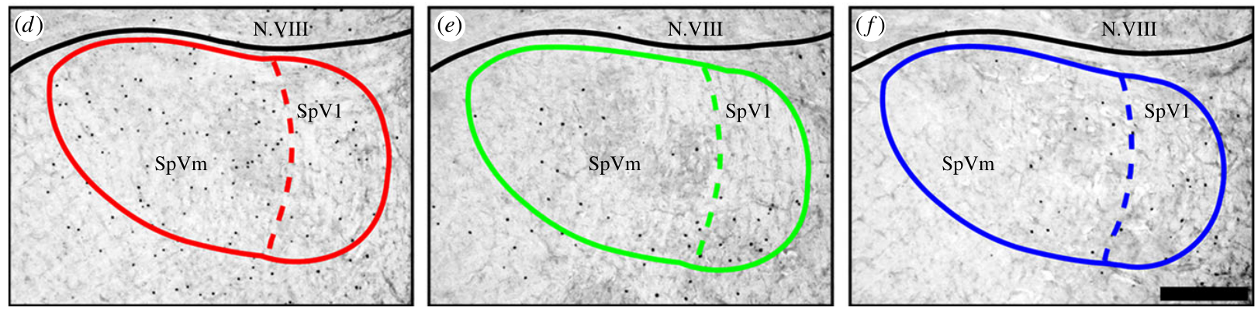
Spinal trigeminal activation requires intact afferents
The spinal trigeminal nucleus, or SpV, receives descending trigeminal sensory input. Lefeldt and colleagues distinguished medial and lateral subdivisions, allowing the magnetic response to be localized rather than assigning all labeled cells to one undifferentiated brainstem region.
The medial subdivision showed the strongest increase under changing magnetic fields, and bilateral V1 section reduced activation. Source sections compare changing-field, zero-field and sectioned conditions directly, with a 200 µm scale bar for the spinal nucleus.
The loss after section supports a contribution from V1-transmitted information. It does not establish that the activated SpV cells form a magnetic map or that they are sufficient for choosing a homeward course; the experiment measured labeling without a homing task.
Lefeldt et al. (2014), Fig. 1d–f. Spinal trigeminal nucleus activation across treatments.
Lefeldt et al. (2014)
30
Notes:
• The **spinal trigeminal nucleus**, or SpV, receives descending trigeminal sensory input. Lefeldt and colleagues distinguished medial and lateral subdivisions, allowing the magnetic response to be localized rather than assigning all labeled cells to one undifferentiated brainstem region.
• The medial subdivision showed the strongest increase under changing magnetic fields, and bilateral V1 section reduced activation. Source sections compare changing-field, zero-field and sectioned conditions directly, with a 200 µm scale bar for the spinal nucleus.
• The loss after section supports a contribution from V1-transmitted information. It does not establish that the activated SpV cells form a magnetic map or that they are sufficient for choosing a homeward course; the experiment measured labeling without a homing task.
References:
Lefeldt N, Heyers D, Schneider NL, Engels S, Elbers D, Mouritsen H (2014). Magnetic field-driven induction of ZENK in the trigeminal system of pigeons (Columba livia). Journal of the Royal Society Interface 11(100):20140777. https://doi.org/10.1098/rsif.2014.0777
Figure: Lefeldt et al. (2014), Fig. 1d–f. Spinal trigeminal nucleus activation across treatments.
Figure source: https://doi.org/10.1098/rsif.2014.0777

Slide 31
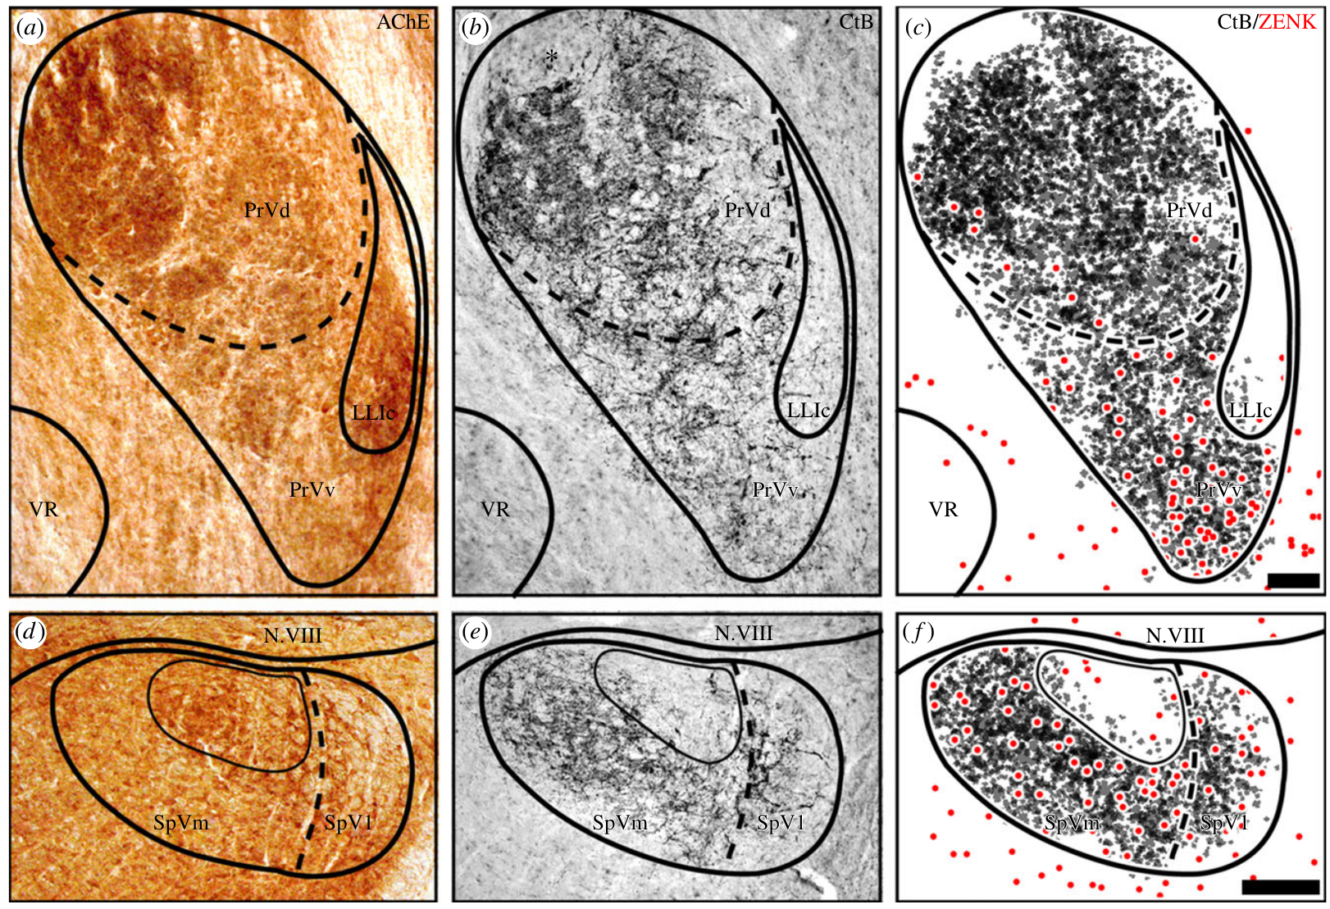
Anatomical tracing links afferents with activated regions
Neuronal tracing labels anatomical pathways from an injection site. Lefeldt and colleagues introduced cholera toxin B into V1 to identify its central projections, then compared labeled afferents with regions containing ZENK-positive neurons after magnetic stimulation.
V1 fibers terminated in the principal and spinal trigeminal nuclei. The published overlays preserve the spatial relationship between traced fibers and activation, with 100 µm and 200 µm scales. Acetylcholinesterase staining supplied anatomical boundaries for locating the subdivisions.
Regional overlap supports a plausible route for peripheral signals to reach the responsive tissue. It does not establish a functional synapse onto each labeled cell. Acetylcholinesterase used as an anatomical marker also does not prove that acetylcholine transmits the putative magnetic signal.
Lefeldt et al. (2014), Fig. 2a–f. Trigeminal anatomy, afferent tracing and ZENK labeling.
Lefeldt et al. (2014)
31
Notes:
• **Neuronal tracing** labels anatomical pathways from an injection site. Lefeldt and colleagues introduced cholera toxin B into V1 to identify its central projections, then compared labeled afferents with regions containing ZENK-positive neurons after magnetic stimulation.
• V1 fibers terminated in the principal and spinal trigeminal nuclei. The published overlays preserve the spatial relationship between traced fibers and activation, with 100 µm and 200 µm scales. Acetylcholinesterase staining supplied anatomical boundaries for locating the subdivisions.
• Regional overlap supports a plausible route for peripheral signals to reach the responsive tissue. It does not establish a functional synapse onto each labeled cell. Acetylcholinesterase used as an anatomical marker also does not prove that acetylcholine transmits the putative magnetic signal.
References:
Lefeldt N, Heyers D, Schneider NL, Engels S, Elbers D, Mouritsen H (2014). Magnetic field-driven induction of ZENK in the trigeminal system of pigeons (Columba livia). Journal of the Royal Society Interface 11(100):20140777. https://doi.org/10.1098/rsif.2014.0777
Figure: Lefeldt et al. (2014), Fig. 2a–f. Trigeminal anatomy, afferent tracing and ZENK labeling.
Figure source: https://doi.org/10.1098/rsif.2014.0777

Slide 32
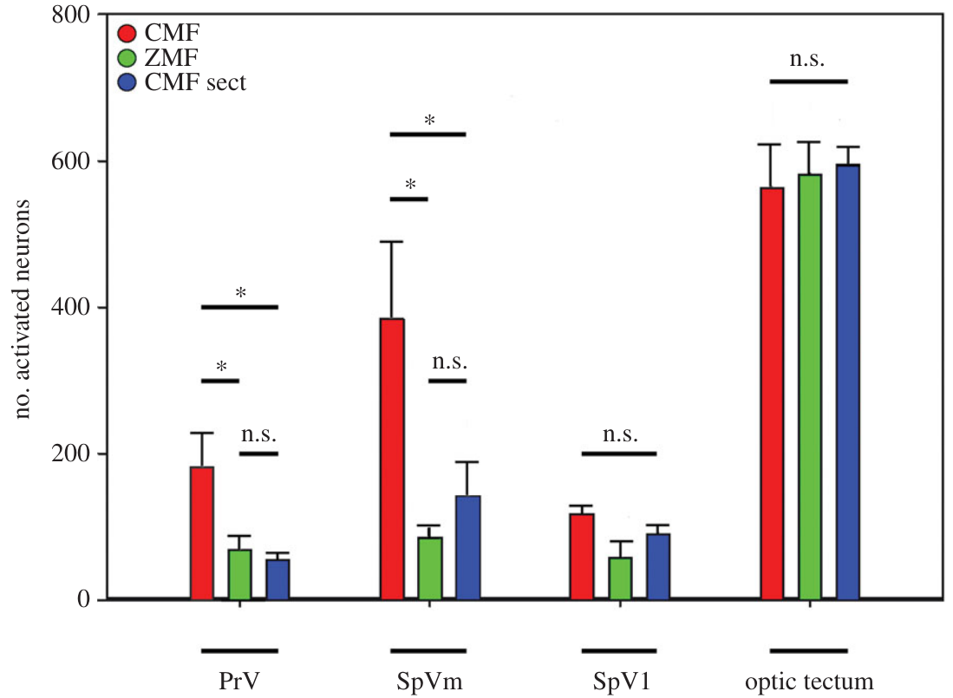
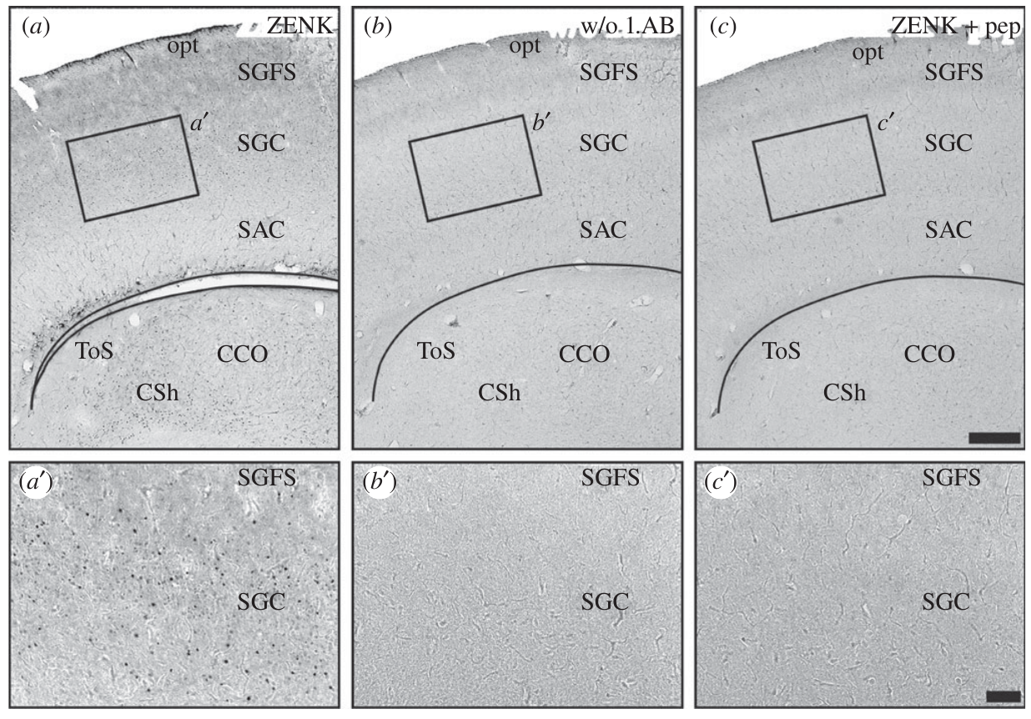
Nerve section and control regions constrain the response
A loss-of-function test interrupts a candidate pathway and measures the remaining response. Lefeldt and colleagues cut both V1 branches, then exposed the birds to the same changing magnetic stimulus used for intact animals.
Trigeminal activation decreased after section, whereas the optic tectum, a midbrain sensory region included as a comparison, did not differ appreciably among the magnetic conditions. Counts were collected after 3 h of exposure, with field and nerve manipulations compared separately.
This specificity argues against uniform activation of all measured brain regions. It does not establish the molecular transducer or the bird’s perceptual experience. The unchanged tectal control cannot rule out every other visual or magnetic pathway in the brain.
Lefeldt et al. (2014), Fig. 6a–c and enlargements. Optic tectum anatomy and antibody-staining controls.
Lefeldt et al. (2014), Fig. 3. Activation in trigeminal regions and the optic tectum.
Lefeldt et al. (2014)
32
Notes:
• A **loss-of-function test** interrupts a candidate pathway and measures the remaining response. Lefeldt and colleagues cut both V1 branches, then exposed the birds to the same changing magnetic stimulus used for intact animals.
• Trigeminal activation decreased after section, whereas the **optic tectum**, a midbrain sensory region included as a comparison, did not differ appreciably among the magnetic conditions. Counts were collected after 3 h of exposure, with field and nerve manipulations compared separately.
• This specificity argues against uniform activation of all measured brain regions. It does not establish the molecular transducer or the bird’s perceptual experience. The unchanged tectal control cannot rule out every other visual or magnetic pathway in the brain.
References:
Lefeldt N, Heyers D, Schneider NL, Engels S, Elbers D, Mouritsen H (2014). Magnetic field-driven induction of ZENK in the trigeminal system of pigeons (Columba livia). Journal of the Royal Society Interface 11(100):20140777. https://doi.org/10.1098/rsif.2014.0777
Figure: Lefeldt et al. (2014), Fig. 3. Activation in trigeminal regions and the optic tectum.
Figure source: https://doi.org/10.1098/rsif.2014.0777
Figure: Lefeldt et al. (2014), Fig. 6a–c and enlargements. Optic tectum anatomy and antibody-staining controls.
Figure source: https://doi.org/10.1098/rsif.2014.0777

Slide 33
Behavioral controls limit a mechanical explanation
V1 also carries ordinary mechanical information from the head, so pecking, grooming and contact with the cage could activate its receiving nuclei. A magnetic manipulation requires behavioral controls before increased trigeminal labeling can be assigned to field-dependent input.
Lefeldt and colleagues monitored pigeons with infrared cameras during the 3 h exposure and quantified movement and beak contacts. They found no systematic positive relationship explaining the regional ZENK increase as a consequence of more mechanical stimulation under the changing-field condition.
The controls reduce a simple contact-driven account without identifying the sensory receptor. The experiment also supplied no stable navigational direction and did not ask the pigeons to orient; neural responsiveness must be distinguished from evidence for a behavioral compass or map.
Lefeldt et al. (2014), Fig. 1a–f. ZENK labeling after magnetic stimulation and nerve section.
Lefeldt et al. (2014)
33
Notes:
• V1 also carries ordinary mechanical information from the head, so pecking, grooming and contact with the cage could activate its receiving nuclei. A magnetic manipulation requires behavioral controls before increased trigeminal labeling can be assigned to field-dependent input.
• Lefeldt and colleagues monitored pigeons with infrared cameras during the 3 h exposure and quantified movement and beak contacts. They found no systematic positive relationship explaining the regional ZENK increase as a consequence of more mechanical stimulation under the changing-field condition.
• The controls reduce a simple contact-driven account without identifying the sensory receptor. The experiment also supplied no stable navigational direction and did not ask the pigeons to orient; neural responsiveness must be distinguished from evidence for a behavioral compass or map.
References:
Lefeldt N, Heyers D, Schneider NL, Engels S, Elbers D, Mouritsen H (2014). Magnetic field-driven induction of ZENK in the trigeminal system of pigeons (Columba livia). Journal of the Royal Society Interface 11(100):20140777. https://doi.org/10.1098/rsif.2014.0777
Figure: Lefeldt et al. (2014), Fig. 1a–f. ZENK labeling after magnetic stimulation and nerve section.
Figure source: https://doi.org/10.1098/rsif.2014.0777

Slide 34
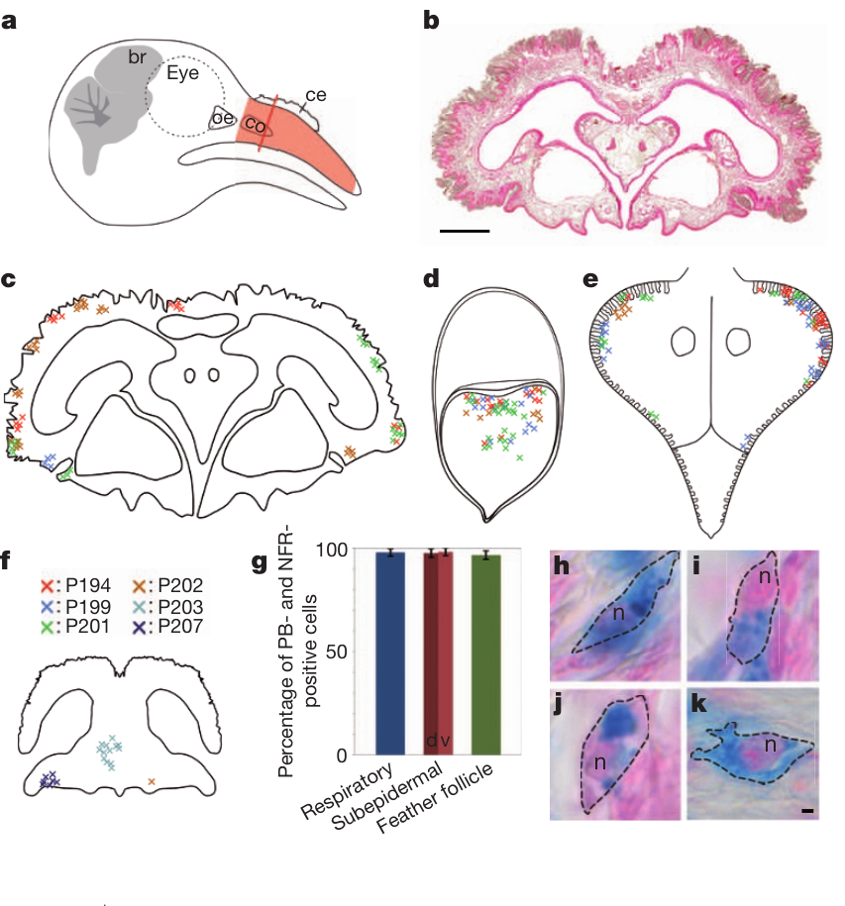
Iron-rich beak cells require independent identification
Magnetite is an iron oxide proposed as a material for magnetic sensory transduction. Finding iron in tissue is insufficient to identify a magnetic receptor, because iron also occurs in metabolic storage and immune cells.
Treiber and colleagues stained pigeon upper beaks with Prussian blue, which detects ferric iron, and mapped labeled cells through serial sections. Iron-rich cells occurred in respiratory epithelium, subepidermal tissue and feather follicles. The source preserves the anatomy of these distinct tissue locations.
The observations challenge identification by position and iron content alone. Prussian blue is not a selective test for magnetite or neurons, so additional cellular markers and ultrastructure were needed before assigning a sensory function to the stained cells.
Treiber et al. (2012), Fig. 1a–k. Anatomical distribution and nucleation of iron-rich beak cells.
Treiber et al. (2012)
34
Notes:
• **Magnetite** is an iron oxide proposed as a material for magnetic sensory transduction. Finding iron in tissue is insufficient to identify a magnetic receptor, because iron also occurs in metabolic storage and immune cells.
• Treiber and colleagues stained pigeon upper beaks with **Prussian blue**, which detects ferric iron, and mapped labeled cells through serial sections. Iron-rich cells occurred in respiratory epithelium, subepidermal tissue and feather follicles. The source preserves the anatomy of these distinct tissue locations.
• The observations challenge identification by position and iron content alone. Prussian blue is not a selective test for magnetite or neurons, so additional cellular markers and ultrastructure were needed before assigning a sensory function to the stained cells.
References:
Treiber CD, Salzer MC, Riegler J, Edelman N, Sugar C, Breuss M, Pichler P, Cadiou H, Saunders M, Lythgoe M, Shaw J, Keays DA (2012). Clusters of iron-rich cells in the upper beak of pigeons are macrophages not magnetosensitive neurons. Nature 484(7394):367–370. https://doi.org/10.1038/nature11046
Figure: Treiber et al. (2012), Fig. 1a–k. Anatomical distribution and nucleation of iron-rich beak cells.
Figure source: https://doi.org/10.1038/nature11046

Slide 35
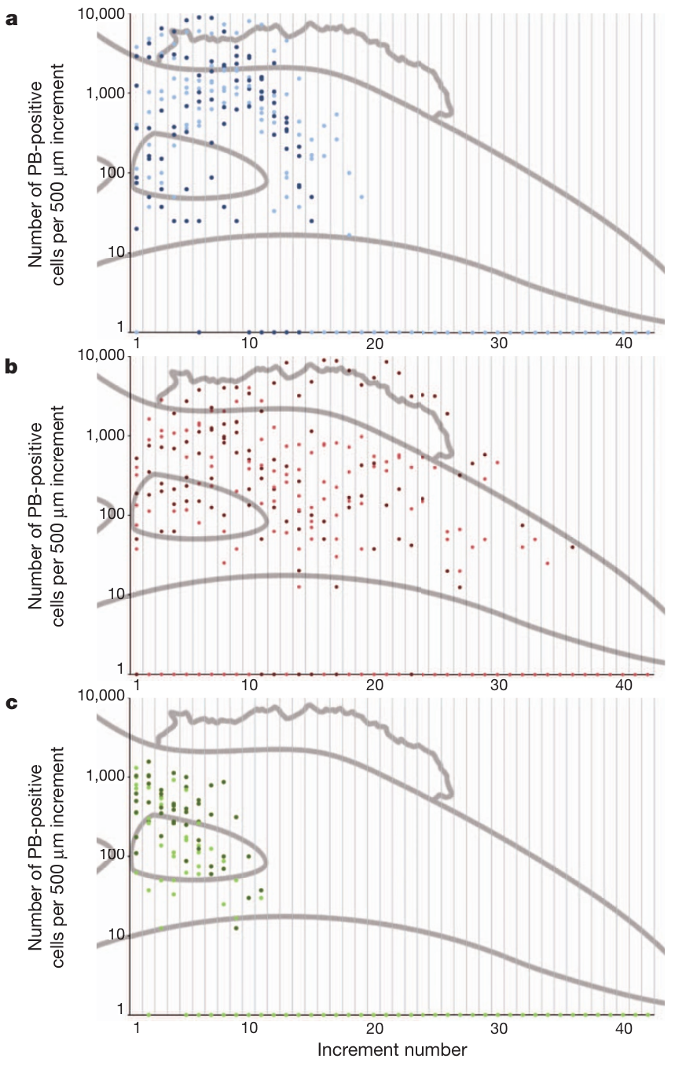
Iron-positive cells do not form a fixed bilateral array
A reproducible sensory organ should have an anatomical organization consistent with its proposed function. Earlier descriptions had assigned magnetoreception to six bilateral iron-rich clusters in the upper beak, but that claim required systematic examination across individuals.
Treiber and colleagues counted Prussian-blue-positive cells in successive 500 µm increments along the beak. Their locations and numbers varied widely among pigeons, with cells distributed through multiple tissues rather than a consistent six-cluster arrangement.
The distribution does not fit the claimed stereotyped receptor array. Variation alone cannot exclude every possible sensory cell elsewhere in the beak, but it removes a central anatomical premise of that specific magnetic-receptor account.
Treiber et al. (2012), Fig. 2a–c. Variable distribution of iron-positive cells along the beak.
Treiber et al. (2012)
35
Notes:
• A reproducible sensory organ should have an anatomical organization consistent with its proposed function. Earlier descriptions had assigned magnetoreception to six bilateral iron-rich clusters in the upper beak, but that claim required systematic examination across individuals.
• Treiber and colleagues counted Prussian-blue-positive cells in successive 500 µm increments along the beak. Their locations and numbers varied widely among pigeons, with cells distributed through multiple tissues rather than a consistent six-cluster arrangement.
• The distribution does not fit the claimed stereotyped receptor array. Variation alone cannot exclude every possible sensory cell elsewhere in the beak, but it removes a central anatomical premise of that specific magnetic-receptor account.
References:
Treiber CD, Salzer MC, Riegler J, Edelman N, Sugar C, Breuss M, Pichler P, Cadiou H, Saunders M, Lythgoe M, Shaw J, Keays DA (2012). Clusters of iron-rich cells in the upper beak of pigeons are macrophages not magnetosensitive neurons. Nature 484(7394):367–370. https://doi.org/10.1038/nature11046
Figure: Treiber et al. (2012), Fig. 2a–c. Variable distribution of iron-positive cells along the beak.
Figure source: https://doi.org/10.1038/nature11046

Slide 36
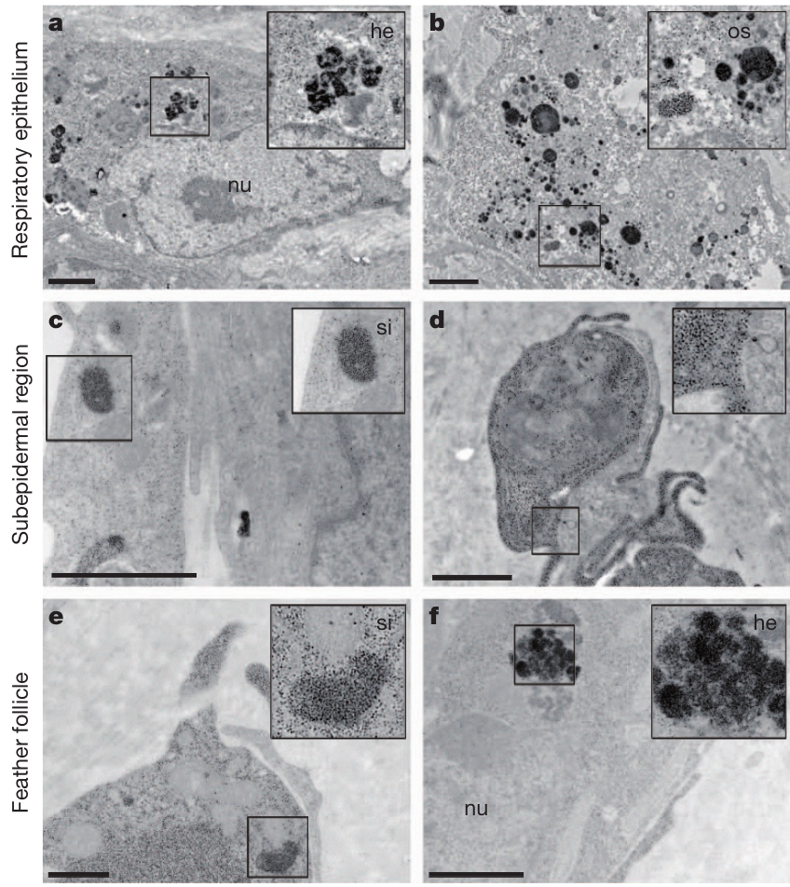
Ultrastructure identifies iron-storage compartments
Ultrastructure is cellular organization resolved with electron microscopy. Treiber and colleagues examined iron-rich beak cells in three tissue compartments rather than assuming that their blue staining indicated sensory dendrites.
Cells contained ferritin-like granules 6–9 nm in diameter, haemosiderin, an aggregated iron-storage material, and membrane-bound iron-containing compartments termed siderosomes. The source micrographs retain 1 µm scale bars and the labeled cellular structures.
These features are consistent with cellular iron storage rather than the proposed specialized magnetite receptor. Electron microscopy and material analyses did not identify the claimed sensory magnetite organization, but this negative result concerns the sampled iron-rich cells, not every possible magnetic transduction mechanism.
Treiber et al. (2012), Fig. 3a–f. Ultrastructure of iron-rich cells in three beak tissues.
Treiber et al. (2012)
36
Notes:
• **Ultrastructure** is cellular organization resolved with electron microscopy. Treiber and colleagues examined iron-rich beak cells in three tissue compartments rather than assuming that their blue staining indicated sensory dendrites.
• Cells contained ferritin-like granules 6–9 nm in diameter, **haemosiderin**, an aggregated iron-storage material, and membrane-bound iron-containing compartments termed **siderosomes**. The source micrographs retain 1 µm scale bars and the labeled cellular structures.
• These features are consistent with cellular iron storage rather than the proposed specialized magnetite receptor. Electron microscopy and material analyses did not identify the claimed sensory magnetite organization, but this negative result concerns the sampled iron-rich cells, not every possible magnetic transduction mechanism.
References:
Treiber CD, Salzer MC, Riegler J, Edelman N, Sugar C, Breuss M, Pichler P, Cadiou H, Saunders M, Lythgoe M, Shaw J, Keays DA (2012). Clusters of iron-rich cells in the upper beak of pigeons are macrophages not magnetosensitive neurons. Nature 484(7394):367–370. https://doi.org/10.1038/nature11046
Figure: Treiber et al. (2012), Fig. 3a–f. Ultrastructure of iron-rich cells in three beak tissues.
Figure source: https://doi.org/10.1038/nature11046

Slide 37
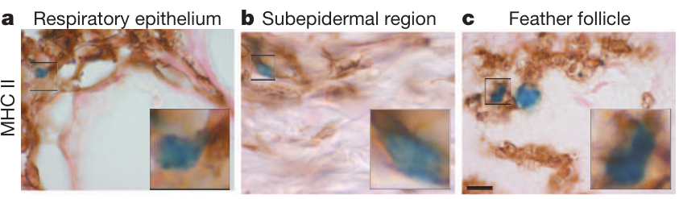
Immune labeling identifies macrophages in beak tissue
Macrophages are immune cells that engulf material and participate in tissue defense. MHC II is a cell-surface antigen-presentation marker expressed by several immune cell types. Treiber and colleagues combined this marker with iron staining to determine the identity of the beak cells.
MHC II labeling colocalized with iron-positive cells in respiratory epithelium, subepidermal tissue and feather follicles. Combined with their ultrastructure and lack of convincing neuronal-marker labeling, the findings supported macrophages rather than magnetosensitive neurons. The micrographs preserve a 10 µm scale.
Cell identity matters because iron accumulation in a macrophage need not transduce magnetic information. MHC II alone is not a uniquely macrophage-specific test; the inference relies on converging morphology, marker expression and material evidence across the sampled tissues.
Treiber et al. (2012), Fig. 4a–c. MHC II staining of iron-positive beak cells.
Treiber et al. (2012)
37
Notes:
• **Macrophages** are immune cells that engulf material and participate in tissue defense. **MHC II** is a cell-surface antigen-presentation marker expressed by several immune cell types. Treiber and colleagues combined this marker with iron staining to determine the identity of the beak cells.
• MHC II labeling colocalized with iron-positive cells in respiratory epithelium, subepidermal tissue and feather follicles. Combined with their ultrastructure and lack of convincing neuronal-marker labeling, the findings supported macrophages rather than magnetosensitive neurons. The micrographs preserve a 10 µm scale.
• Cell identity matters because iron accumulation in a macrophage need not transduce magnetic information. MHC II alone is not a uniquely macrophage-specific test; the inference relies on converging morphology, marker expression and material evidence across the sampled tissues.
References:
Treiber CD, Salzer MC, Riegler J, Edelman N, Sugar C, Breuss M, Pichler P, Cadiou H, Saunders M, Lythgoe M, Shaw J, Keays DA (2012). Clusters of iron-rich cells in the upper beak of pigeons are macrophages not magnetosensitive neurons. Nature 484(7394):367–370. https://doi.org/10.1038/nature11046
Figure: Treiber et al. (2012), Fig. 4a–c. MHC II staining of iron-positive beak cells.
Figure source: https://doi.org/10.1038/nature11046

Slide 38
An invalid receptor candidate leaves a pathway unresolved
A peripheral cell candidate and a responsive neural pathway are distinct claims. Treiber and colleagues rejected the identification of the sampled iron-rich beak cells as magnetosensitive neurons, using histology, immune labeling and electron microscopy.
Lefeldt and colleagues subsequently found magnetic-field-related ZENK induction in trigeminal nuclei that depended on intact V1 after 3 h of exposure. Those data establish a pathway-associated response without locating the transducer among the cells characterized by Treiber and colleagues.
The results can coexist: the earlier beak-cell candidate fails while the origin of the V1-associated response remains unresolved. Neither experiment identifies a magnetic receptor molecule, a mechanically gated channel or a complete causal circuit for homing behavior.
Treiber et al. (2012), Fig. 1a–k. Anatomical distribution and nucleation of iron-rich beak cells.
Treiber et al. (2012); Lefeldt et al. (2014)
38
Notes:
• A peripheral cell candidate and a responsive neural pathway are distinct claims. Treiber and colleagues rejected the identification of the sampled iron-rich beak cells as magnetosensitive neurons, using histology, immune labeling and electron microscopy.
• Lefeldt and colleagues subsequently found magnetic-field-related ZENK induction in trigeminal nuclei that depended on intact V1 after 3 h of exposure. Those data establish a pathway-associated response without locating the transducer among the cells characterized by Treiber and colleagues.
• The results can coexist: the earlier beak-cell candidate fails while the origin of the V1-associated response remains unresolved. Neither experiment identifies a magnetic receptor molecule, a mechanically gated channel or a complete causal circuit for homing behavior.
References:
Treiber CD, Salzer MC, Riegler J, Edelman N, Sugar C, Breuss M, Pichler P, Cadiou H, Saunders M, Lythgoe M, Shaw J, Keays DA (2012). Clusters of iron-rich cells in the upper beak of pigeons are macrophages not magnetosensitive neurons. Nature 484(7394):367–370. https://doi.org/10.1038/nature11046
Lefeldt N, Heyers D, Schneider NL, Engels S, Elbers D, Mouritsen H (2014). Magnetic field-driven induction of ZENK in the trigeminal system of pigeons (Columba livia). Journal of the Royal Society Interface 11(100):20140777. https://doi.org/10.1098/rsif.2014.0777
Figure: Treiber et al. (2012), Fig. 1a–k. Anatomical distribution and nucleation of iron-rich beak cells.
Figure source: https://doi.org/10.1038/nature11046

Slide 39
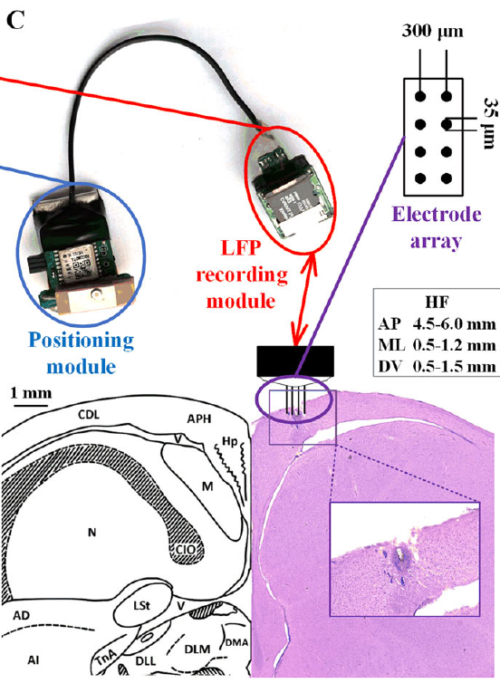
Wearable recordings connect brain signals with flight
A local field potential, or LFP, is an extracellular voltage reflecting coordinated activity and transmembrane currents in surrounding neural tissue. It differs from the isolated action potentials of an identified single neuron.
Yang and colleagues recorded hippocampal LFPs together with position during outdoor pigeon homing. Electrodes sampled the left hippocampal formation, while the positional recorder tracked the flight. Release sites were more than 0.8 km from the loft, and trials used clear weather with low wind.
The paired records associate neural state with behavior under natural movement conditions. They do not identify a neuron encoding a home vector or establish which transmitter generates the signal; population activity and movement artifacts require separate interpretation.
Yang et al. (2025), Fig. 1C. Recording devices and hippocampal electrode placement.
Yang et al. (2025)
39
Notes:
• A **local field potential**, or LFP, is an extracellular voltage reflecting coordinated activity and transmembrane currents in surrounding neural tissue. It differs from the isolated action potentials of an identified single neuron.
• Yang and colleagues recorded hippocampal LFPs together with position during outdoor pigeon homing. Electrodes sampled the left hippocampal formation, while the positional recorder tracked the flight. Release sites were more than 0.8 km from the loft, and trials used clear weather with low wind.
• The paired records associate neural state with behavior under natural movement conditions. They do not identify a neuron encoding a home vector or establish which transmitter generates the signal; population activity and movement artifacts require separate interpretation.
References:
Yang L, Li M, Yang L, Wang Z, Shang Z (2025). Hippocampal LFP Responses during Pigeon Homing Flight in Outdoors. Journal of Neuroscience 45(30):e0185252025. https://doi.org/10.1523/JNEUROSCI.0185-25.2025
Figure: Yang et al. (2025), Fig. 1C. Recording devices and hippocampal electrode placement.
Figure source: https://doi.org/10.1523/JNEUROSCI.0185-25.2025

Slide 40
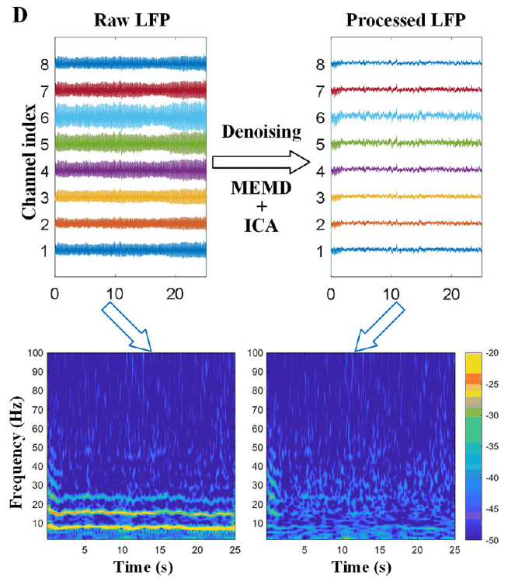
Raw recordings require artifact-aware interpretation
Flight produces muscle activity and electrode movement that can contaminate neural recordings. Denoising separates estimated signal components to reduce these contributions, but processed data must still be compared with the original voltages.
Yang and colleagues used multivariate empirical mode decomposition followed by independent component analysis. The source preserves raw and processed multichannel hippocampal traces and their time–frequency power. Recordings spanned the transition from initial circling to directed flight toward the loft.
The analysis supports stage-associated differences that survived the reported processing comparisons. It cannot exclude every residual artifact or assign each frequency component to a particular cell type. A recording during movement remains correlational even when its preprocessing is carefully controlled.
Yang et al. (2025), Fig. 1C. Recording devices and hippocampal electrode placement.
Yang et al. (2025), Fig. 1D. Raw and processed hippocampal recordings.
Yang et al. (2025)
40
Notes:
• Flight produces muscle activity and electrode movement that can contaminate neural recordings. **Denoising** separates estimated signal components to reduce these contributions, but processed data must still be compared with the original voltages.
• Yang and colleagues used multivariate empirical mode decomposition followed by independent component analysis. The source preserves raw and processed multichannel hippocampal traces and their time–frequency power. Recordings spanned the transition from initial circling to directed flight toward the loft.
• The analysis supports stage-associated differences that survived the reported processing comparisons. It cannot exclude every residual artifact or assign each frequency component to a particular cell type. A recording during movement remains correlational even when its preprocessing is carefully controlled.
References:
Yang L, Li M, Yang L, Wang Z, Shang Z (2025). Hippocampal LFP Responses during Pigeon Homing Flight in Outdoors. Journal of Neuroscience 45(30):e0185252025. https://doi.org/10.1523/JNEUROSCI.0185-25.2025
Figure: Yang et al. (2025), Fig. 1D. Raw and processed hippocampal recordings.
Figure source: https://doi.org/10.1523/JNEUROSCI.0185-25.2025
Figure: Yang et al. (2025), Fig. 1C. Recording devices and hippocampal electrode placement.
Figure source: https://doi.org/10.1523/JNEUROSCI.0185-25.2025

Slide 41
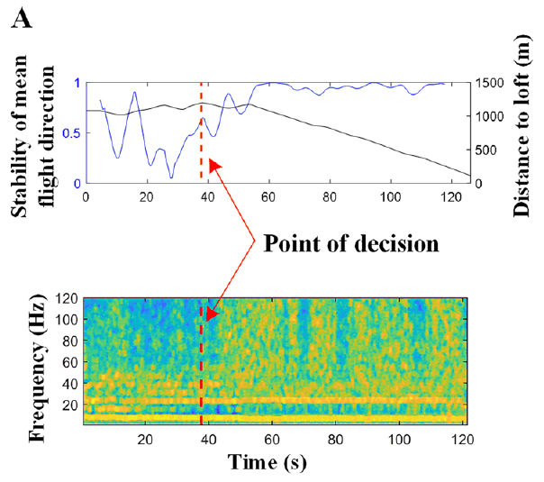
Initial circling differs from sustained homeward flight
The initial decision-making stage, abbreviated DM, is the early circling or exploratory portion of a homing flight. The en route stage, abbreviated ER, begins when the bird adopts a more stable direction toward home. These are behavioral classifications rather than direct measurements of subjective decisions.
Yang and colleagues identified the transition from heading stability and distance to the loft, then aligned hippocampal frequency power with that point. The published example tracks both variables over seconds and retains the LFP frequency axis in hertz.
The alignment relates neural changes to a defined transition in behavior. It does not prove that the hippocampal signal caused the turn, or that a single instant marks completion of every sensory and memory process involved in selecting the route.
Yang et al. (2025), Fig. 2A. Flight direction, distance and hippocampal frequency power.
Yang et al. (2025), Fig. 1C. Recording devices and hippocampal electrode placement.
Yang et al. (2025)
41
Notes:
• The **initial decision-making stage**, abbreviated DM, is the early circling or exploratory portion of a homing flight. The **en route stage**, abbreviated ER, begins when the bird adopts a more stable direction toward home. These are behavioral classifications rather than direct measurements of subjective decisions.
• Yang and colleagues identified the transition from heading stability and distance to the loft, then aligned hippocampal frequency power with that point. The published example tracks both variables over seconds and retains the LFP frequency axis in hertz.
• The alignment relates neural changes to a defined transition in behavior. It does not prove that the hippocampal signal caused the turn, or that a single instant marks completion of every sensory and memory process involved in selecting the route.
References:
Yang L, Li M, Yang L, Wang Z, Shang Z (2025). Hippocampal LFP Responses during Pigeon Homing Flight in Outdoors. Journal of Neuroscience 45(30):e0185252025. https://doi.org/10.1523/JNEUROSCI.0185-25.2025
Figure: Yang et al. (2025), Fig. 2A. Flight direction, distance and hippocampal frequency power.
Figure source: https://doi.org/10.1523/JNEUROSCI.0185-25.2025
Figure: Yang et al. (2025), Fig. 1C. Recording devices and hippocampal electrode placement.
Figure source: https://doi.org/10.1523/JNEUROSCI.0185-25.2025

Slide 42
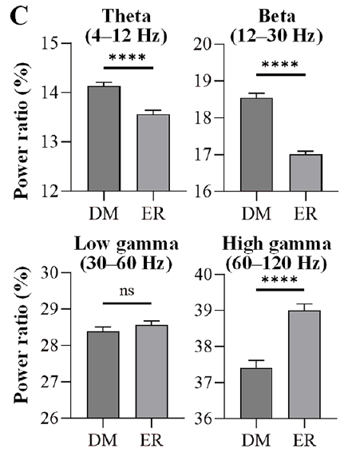
Navigation stages redistribute hippocampal band power
Spectral power measures the contribution of a frequency range to a recorded voltage signal. Yang and colleagues defined theta as 4–12 Hz, beta as 12–30 Hz, low gamma as 30–60 Hz and high gamma as 60–120 Hz.
Theta and beta power ratios were higher during initial decision-making than during en route flight. High-gamma power ratio was greater en route, whereas low gamma lacked the same consistent stage difference. The comparisons used paired behavioral stages within the recorded homing flights.
The pattern supports different population activity across flight stages rather than a uniform increase in every band. Frequency bands do not independently identify a transmitter, inhibitory interneuron or ion channel, and power differences alone cannot establish the content of the spatial representation.
Yang et al. (2025), Fig. 1C. Recording devices and hippocampal electrode placement.
Yang et al. (2025), Fig. 2C. Frequency-band power during initial and en route navigation.
Yang et al. (2025)
42
Notes:
• **Spectral power** measures the contribution of a frequency range to a recorded voltage signal. Yang and colleagues defined theta as 4–12 Hz, beta as 12–30 Hz, low gamma as 30–60 Hz and high gamma as 60–120 Hz.
• Theta and beta power ratios were higher during initial decision-making than during en route flight. High-gamma power ratio was greater en route, whereas low gamma lacked the same consistent stage difference. The comparisons used paired behavioral stages within the recorded homing flights.
• The pattern supports different population activity across flight stages rather than a uniform increase in every band. Frequency bands do not independently identify a transmitter, inhibitory interneuron or ion channel, and power differences alone cannot establish the content of the spatial representation.
References:
Yang L, Li M, Yang L, Wang Z, Shang Z (2025). Hippocampal LFP Responses during Pigeon Homing Flight in Outdoors. Journal of Neuroscience 45(30):e0185252025. https://doi.org/10.1523/JNEUROSCI.0185-25.2025
Figure: Yang et al. (2025), Fig. 2C. Frequency-band power during initial and en route navigation.
Figure source: https://doi.org/10.1523/JNEUROSCI.0185-25.2025
Figure: Yang et al. (2025), Fig. 1C. Recording devices and hippocampal electrode placement.
Figure source: https://doi.org/10.1523/JNEUROSCI.0185-25.2025

Slide 43
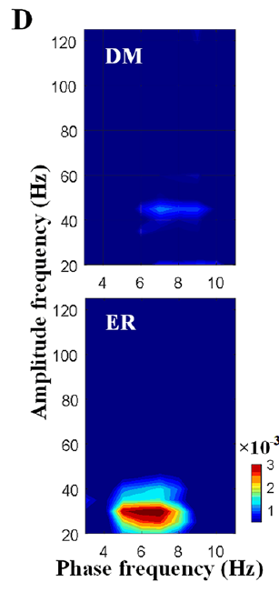
Theta phase organizes beta amplitude during travel
Phase–amplitude coupling means that the amplitude of a faster oscillation varies with the phase of a slower oscillation. Phase specifies position within a repeated voltage cycle, while amplitude measures the size of the faster component.
Yang and colleagues found stronger coupling between theta phase at 5–8 Hz and beta amplitude at 20–30 Hz during en route navigation than during initial decision-making. The source compares the two stages using the same frequency–frequency analysis and its original coupling scale.
The relationship supports stage-dependent coordination of hippocampal population activity. It does not establish information flow from one cell group to another, demonstrate synaptic causation or prove that the oscillations themselves compute the direction and distance to home.
Yang et al. (2025), Fig. 1C. Recording devices and hippocampal electrode placement.
Yang et al. (2025), Fig. 2D. Theta–beta phase–amplitude coupling during navigation.
Yang et al. (2025)
43
Notes:
• **Phase–amplitude coupling** means that the amplitude of a faster oscillation varies with the phase of a slower oscillation. Phase specifies position within a repeated voltage cycle, while amplitude measures the size of the faster component.
• Yang and colleagues found stronger coupling between theta phase at 5–8 Hz and beta amplitude at 20–30 Hz during en route navigation than during initial decision-making. The source compares the two stages using the same frequency–frequency analysis and its original coupling scale.
• The relationship supports stage-dependent coordination of hippocampal population activity. It does not establish information flow from one cell group to another, demonstrate synaptic causation or prove that the oscillations themselves compute the direction and distance to home.
References:
Yang L, Li M, Yang L, Wang Z, Shang Z (2025). Hippocampal LFP Responses during Pigeon Homing Flight in Outdoors. Journal of Neuroscience 45(30):e0185252025. https://doi.org/10.1523/JNEUROSCI.0185-25.2025
Figure: Yang et al. (2025), Fig. 2D. Theta–beta phase–amplitude coupling during navigation.
Figure source: https://doi.org/10.1523/JNEUROSCI.0185-25.2025
Figure: Yang et al. (2025), Fig. 1C. Recording devices and hippocampal electrode placement.
Figure source: https://doi.org/10.1523/JNEUROSCI.0185-25.2025

Slide 44
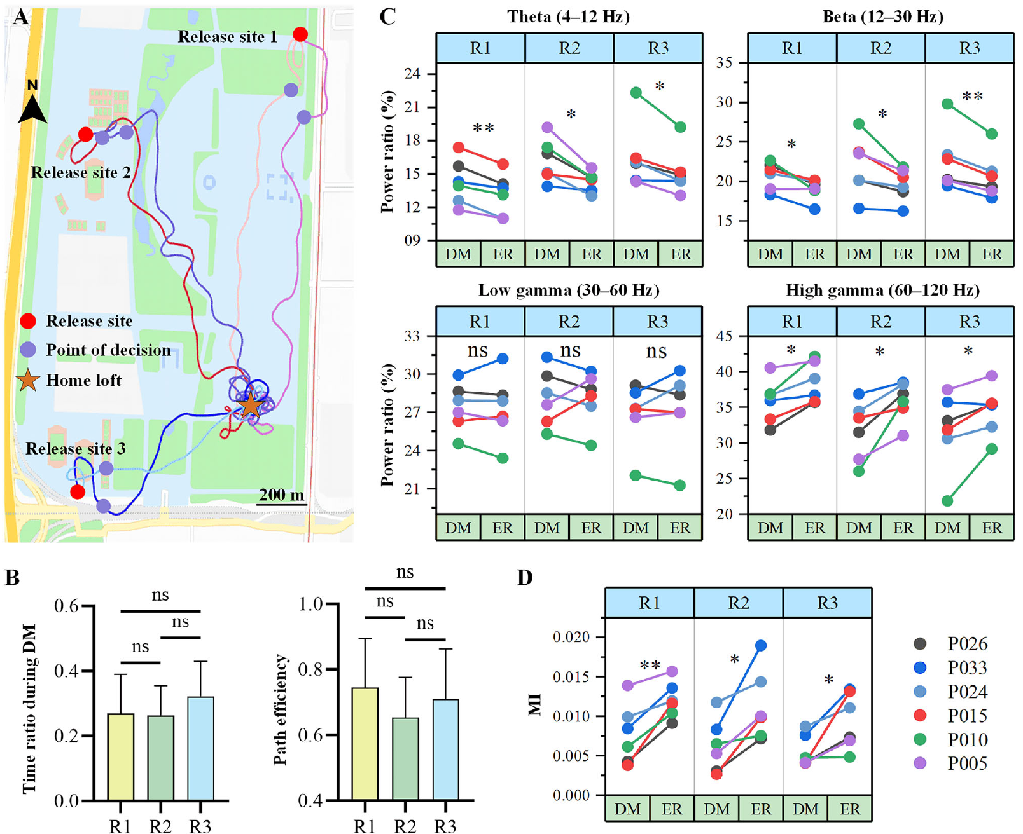
Release direction does not eliminate stage differences
A single release location can confound behavioral stage with a particular heading or piece of terrain. Yang and colleagues alternated among three release sites more than 0.8 km from the loft, comparing initial and en route activity within each direction of approach.
Theta and beta power ratios declined during the transition to en route flight, while high-gamma ratios increased across sites. Theta–beta coupling likewise strengthened en route. The route maps and paired measurements preserve the individual flights and their geographical relationship to the home loft.
Consistency across directions reduces a single-site explanation of the observed neural state. It does not prove generality across long-distance releases, unfamiliar environments or every breed of homing pigeon, because the experiment sampled a specific local setting and recording preparation.
Yang et al. (2025), Fig. 3A–D. Behavior and hippocampal activity across three release sites.
Yang et al. (2025)
44
Notes:
• A single release location can confound behavioral stage with a particular heading or piece of terrain. Yang and colleagues alternated among three release sites more than 0.8 km from the loft, comparing initial and en route activity within each direction of approach.
• Theta and beta power ratios declined during the transition to en route flight, while high-gamma ratios increased across sites. Theta–beta coupling likewise strengthened en route. The route maps and paired measurements preserve the individual flights and their geographical relationship to the home loft.
• Consistency across directions reduces a single-site explanation of the observed neural state. It does not prove generality across long-distance releases, unfamiliar environments or every breed of homing pigeon, because the experiment sampled a specific local setting and recording preparation.
References:
Yang L, Li M, Yang L, Wang Z, Shang Z (2025). Hippocampal LFP Responses during Pigeon Homing Flight in Outdoors. Journal of Neuroscience 45(30):e0185252025. https://doi.org/10.1523/JNEUROSCI.0185-25.2025
Figure: Yang et al. (2025), Fig. 3A–D. Behavior and hippocampal activity across three release sites.
Figure source: https://doi.org/10.1523/JNEUROSCI.0185-25.2025

Slide 45
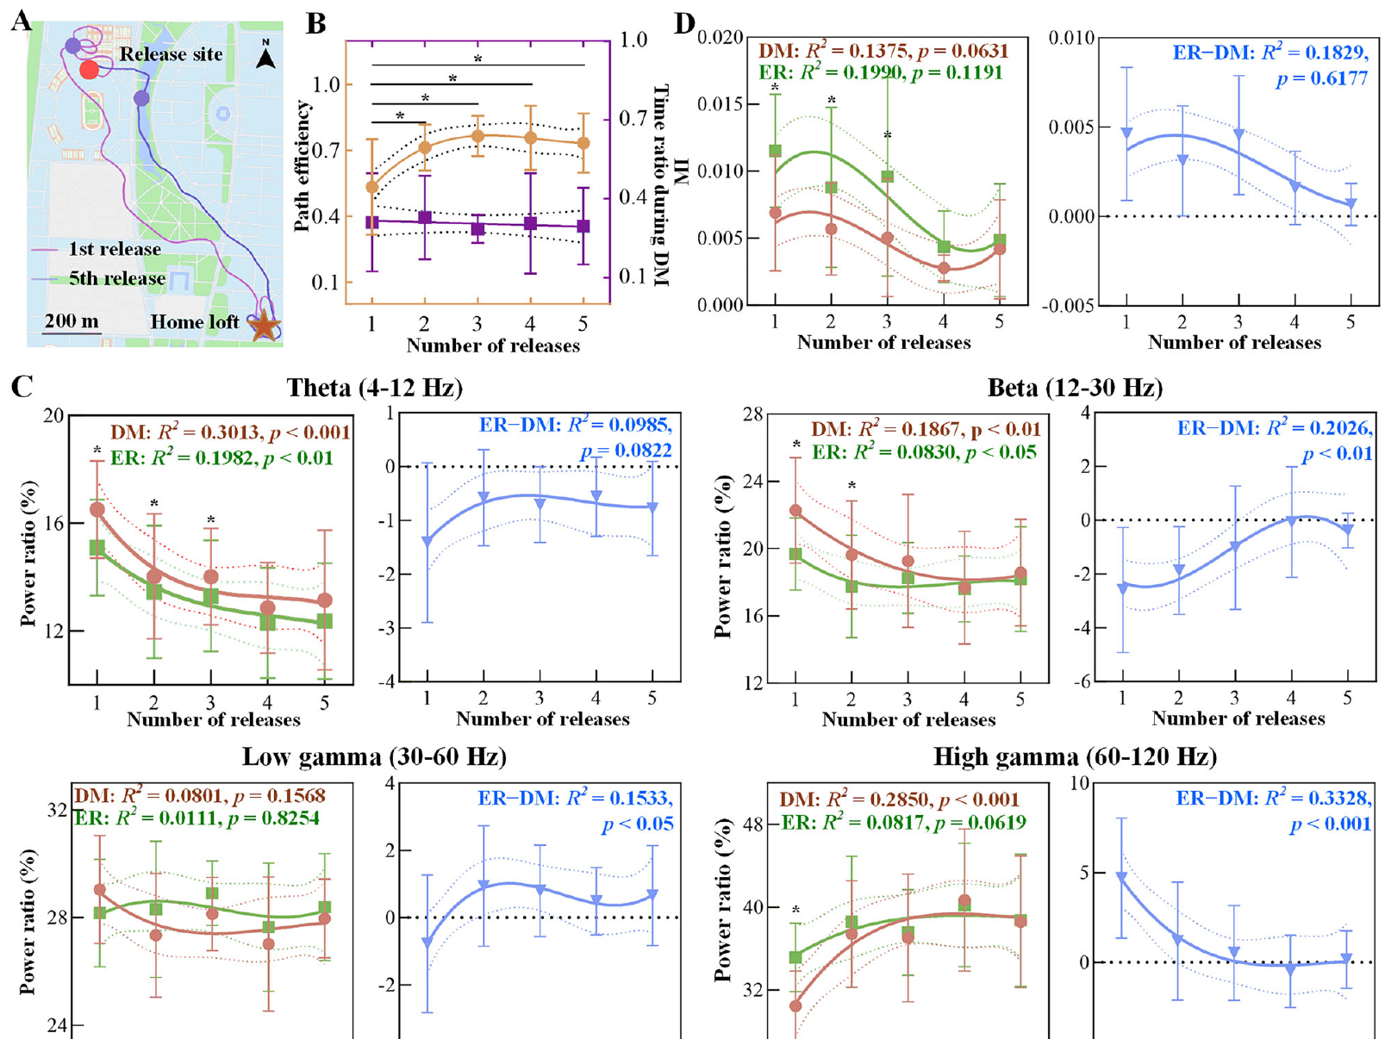
Experience changes routes and neural stage contrasts
Experience-dependent plasticity is a change associated with prior experience; a correlation with repeated journeys does not identify its cellular mechanism. Yang and colleagues compared five homing releases while continuing to record hippocampal activity and position.
Routes became more efficient with repeated release experience. Differences between initial and en route theta, beta and high-gamma power narrowed, and the stage difference in theta–beta coupling also approached zero. The source retains the first and fifth routes and the repeated-release measurements.
The findings link behavioral improvement with changing population activity, but do not identify synaptic storage of landmarks or prove that the measured oscillations drive learning. Odor, compass and visual-route evidence concern separable information sources that can interact within such changing navigational states.
Yang et al. (2025), Fig. 4A–D. Behavior and hippocampal activity across repeated releases.
Yang et al. (2025)
45
Notes:
• **Experience-dependent plasticity** is a change associated with prior experience; a correlation with repeated journeys does not identify its cellular mechanism. Yang and colleagues compared five homing releases while continuing to record hippocampal activity and position.
• Routes became more efficient with repeated release experience. Differences between initial and en route theta, beta and high-gamma power narrowed, and the stage difference in theta–beta coupling also approached zero. The source retains the first and fifth routes and the repeated-release measurements.
• The findings link behavioral improvement with changing population activity, but do not identify synaptic storage of landmarks or prove that the measured oscillations drive learning. Odor, compass and visual-route evidence concern separable information sources that can interact within such changing navigational states.
References:
Yang L, Li M, Yang L, Wang Z, Shang Z (2025). Hippocampal LFP Responses during Pigeon Homing Flight in Outdoors. Journal of Neuroscience 45(30):e0185252025. https://doi.org/10.1523/JNEUROSCI.0185-25.2025
Figure: Yang et al. (2025), Fig. 4A–D. Behavior and hippocampal activity across repeated releases.
Figure source: https://doi.org/10.1523/JNEUROSCI.0185-25.2025

Slide 46
Key takeaways
Map and compass solve different problems: estimating position relative to home and maintaining a directional reference.
Visual pilotage supports individual familiar routes; clock-shifted pigeons can retain route shape while continuing to respond to compass information.
Environmental odors support early homing in the controlled GPS experiment; artificial odor stimulation alone did not restore that performance.
Regional activation links odor exposure and magnetic stimulation with specific brain regions, but immediate-early-gene labeling is not a real-time code or proof of behavioral causation.
Magnetic mechanisms remain partly unresolved: iron-rich beak cells were macrophages, while V1-dependent responses identify an afferent contribution without locating its receptor.
Hippocampal dynamics vary with flight stage and experience; band power and theta–beta coupling are population correlations, not established cellular computations of a home vector.
Biro et al. (2007); Gagliardo et al. (2011); Yang et al. (2025)
46
Notes:
Teaching transcript:
• Map and compass solve different problems: estimating position relative to home and maintaining a directional reference.
• Visual pilotage supports individual familiar routes; clock-shifted pigeons can retain route shape while continuing to respond to compass information.
• Environmental odors support early homing in the controlled GPS experiment; artificial odor stimulation alone did not restore that performance.
• Regional activation links odor exposure and magnetic stimulation with specific brain regions, but immediate-early-gene labeling is not a real-time code or proof of behavioral causation.
• Magnetic mechanisms remain partly unresolved: iron-rich beak cells were macrophages, while V1-dependent responses identify an afferent contribution without locating its receptor.
• Hippocampal dynamics vary with flight stage and experience; band power and theta–beta coupling are population correlations, not established cellular computations of a home vector.
References:
Biro D, Meade J, Guilford T (2004). Familiar route loyalty implies visual pilotage in the homing pigeon. Proceedings of the National Academy of Sciences 101(50):17440–17443. https://doi.org/10.1073/pnas.0406984101
Biro D, Freeman R, Meade J, Roberts S, Guilford T (2007). Pigeons combine compass and landmark guidance in familiar route navigation. Proceedings of the National Academy of Sciences 104(18):7471–7476. https://doi.org/10.1073/pnas.0701575104
Gagliardo A, Ioalè P, Filannino C, Wikelski M (2011). Homing pigeons only navigate in air with intact environmental odours: a test of the olfactory activation hypothesis with GPS data loggers. PLOS ONE 6(8):e22385. https://doi.org/10.1371/journal.pone.0022385
Jorge PE, Phillips JB, Gonçalves A, Marques PAM, Němec P (2014). Odours stimulate neuronal activity in the dorsolateral area of the hippocampal formation during path integration. Proceedings of the Royal Society B 281(1783):20140025. https://doi.org/10.1098/rspb.2014.0025
Treiber CD, Salzer MC, Riegler J, Edelman N, Sugar C, Breuss M, Pichler P, Cadiou H, Saunders M, Lythgoe M, Shaw J, Keays DA (2012). Clusters of iron-rich cells in the upper beak of pigeons are macrophages not magnetosensitive neurons. Nature 484(7394):367–370. https://doi.org/10.1038/nature11046
Lefeldt N, Heyers D, Schneider NL, Engels S, Elbers D, Mouritsen H (2014). Magnetic field-driven induction of ZENK in the trigeminal system of pigeons (Columba livia). Journal of the Royal Society Interface 11(100):20140777. https://doi.org/10.1098/rsif.2014.0777
Yang L, Li M, Yang L, Wang Z, Shang Z (2025). Hippocampal LFP Responses during Pigeon Homing Flight in Outdoors. Journal of Neuroscience 45(30):e0185252025. https://doi.org/10.1523/JNEUROSCI.0185-25.2025

