Slide 1
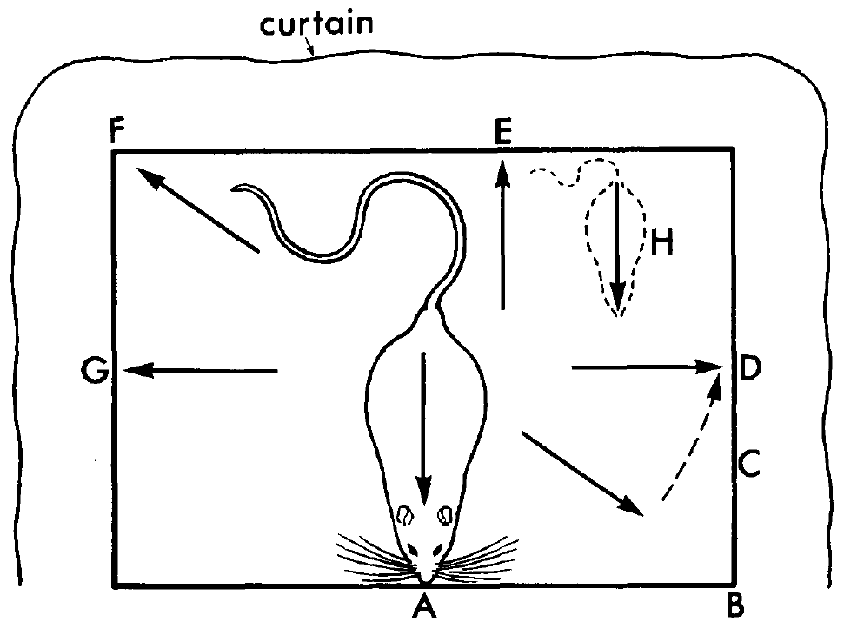
NEUR 411 · NEUROETHOLOGY · FALL 2026
Lecture 37
Spatial cognition:
hippocampal place cells and grid cells (O'Keefe & Moser)
Monday, November 23, 2026
Jordan Lopez, Ph.D.
Professor of Neurobiology & Biomedical Engineering
O'Keefe & Dostrovsky (1971), Fig. 1 (upper). Rat position and orientation on the platform.
Notes:
Spatial cognition: hippocampal place cells and grid cells (O'Keefe & Moser)
Lecture 37. NEUR 411 · NEUROETHOLOGY · FALL 2026. Monday, November 23, 2026.
Figure: O'Keefe & Dostrovsky (1971), Fig. 1 (upper). Rat position and orientation on the platform.
Figure source: https://doi.org/10.1016/0006-8993(71)90358-1

Slide 2
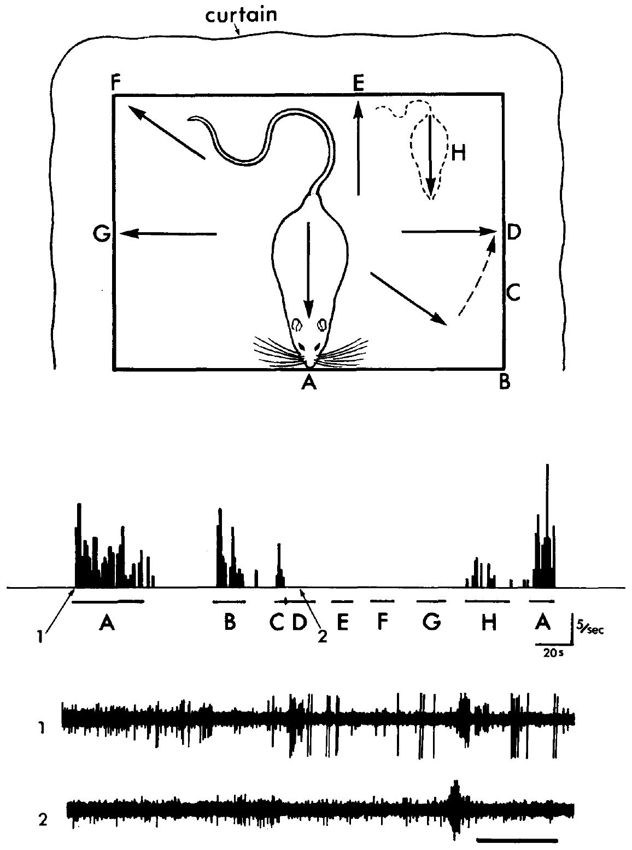
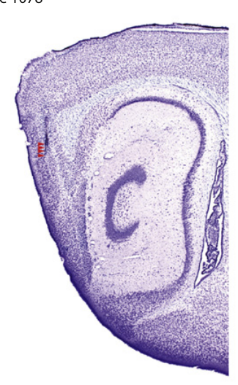
Spatial firing depends on an animal's surroundings
A place cell is a neuron whose activity depends on the animal's location. O'Keefe and Dostrovsky recorded hippocampal units while rats moved on a 24 × 36 cm platform, testing whether neural firing could provide a spatial reference for behavior.
Their clearest CA1 example also required a particular facing direction and a restraining tactile stimulus. Location was therefore one component of a combined response, rather than the only variable controlling the cell.
The proposed cognitive map, an internal representation of spatial relationships, was an interpretation of these responses. The recordings supported spatial coding but did not establish a complete map or identify how it guides a route.
Giocomo et al. (2011), Fig. 3(A, upper histology). Mouse sagittal brain section and entorhinal recording location.
O'Keefe & Dostrovsky (1971), Fig. 1. Spatially dependent CA1 response to restraint.
O'Keefe & Dostrovsky (1971); Giocomo et al. (2011)
02
Notes:
• A **place cell** is a neuron whose activity depends on the animal's location. O'Keefe and Dostrovsky recorded hippocampal units while rats moved on a 24 × 36 cm platform, testing whether neural firing could provide a spatial reference for behavior.
• Their clearest CA1 example also required a particular facing direction and a restraining tactile stimulus. Location was therefore one component of a combined response, rather than the only variable controlling the cell.
• The proposed **cognitive map**, an internal representation of spatial relationships, was an interpretation of these responses. The recordings supported spatial coding but did not establish a complete map or identify how it guides a route.
References:
O'Keefe J, Dostrovsky J (1971). The hippocampus as a spatial map. Preliminary evidence from unit activity in the freely-moving rat. Brain Research 34(1): 171–175. https://doi.org/10.1016/0006-8993(71)90358-1
Giocomo LM, Hussaini SA, Zheng F, Kandel ER, Moser MB, Moser EI (2011). Grid cells use HCN1 channels for spatial scaling. Cell 147(5): 1159–1170. https://doi.org/10.1016/j.cell.2011.08.051
Figure: O'Keefe & Dostrovsky (1971), Fig. 1. Spatially dependent CA1 response to restraint.
Figure source: https://doi.org/10.1016/0006-8993(71)90358-1
Figure: Giocomo et al. (2011), Fig. 3(A, upper histology). Mouse sagittal brain section and entorhinal recording location.
Figure source: https://doi.org/10.1016/j.cell.2011.08.051

Slide 3
Movable electrodes reveal activity during natural behavior
An extracellular recording measures voltage changes outside neurons when they fire action potentials. A lightweight skull-mounted microdrive allowed electrodes to advance through the dorsal hippocampus while the recovered rat walked, groomed, ate, or remained still.
Adjacent recording and reference electrodes fed a differential amplifier, which reduced shared muscle and movement artifacts. The experimental preparation retained behavior that anesthesia would remove, while keeping the recording apparatus attached to the animal.
The authors also tested sounds, moving visual stimuli, odors, and touch. These comparisons distinguished spatially dependent responses from simple sensory responsiveness, although extracellular spikes alone could not identify a neuron's transmitter, dendritic structure, or synaptic inputs.
Giocomo et al. (2011), Fig. 3(A, upper histology). Mouse sagittal brain section and entorhinal recording location.
O'Keefe & Dostrovsky (1971), Fig. 1. Spatially dependent CA1 response to restraint.
O'Keefe & Dostrovsky (1971); Giocomo et al. (2011)
03
Notes:
• An **extracellular recording** measures voltage changes outside neurons when they fire action potentials. A lightweight skull-mounted microdrive allowed electrodes to advance through the dorsal hippocampus while the recovered rat walked, groomed, ate, or remained still.
• Adjacent recording and reference electrodes fed a differential amplifier, which reduced shared muscle and movement artifacts. The experimental preparation retained behavior that anesthesia would remove, while keeping the recording apparatus attached to the animal.
• The authors also tested sounds, moving visual stimuli, odors, and touch. These comparisons distinguished spatially dependent responses from simple sensory responsiveness, although extracellular spikes alone could not identify a neuron's transmitter, dendritic structure, or synaptic inputs.
References:
O'Keefe J, Dostrovsky J (1971). The hippocampus as a spatial map. Preliminary evidence from unit activity in the freely-moving rat. Brain Research 34(1): 171–175. https://doi.org/10.1016/0006-8993(71)90358-1
Giocomo LM, Hussaini SA, Zheng F, Kandel ER, Moser MB, Moser EI (2011). Grid cells use HCN1 channels for spatial scaling. Cell 147(5): 1159–1170. https://doi.org/10.1016/j.cell.2011.08.051
Figure: O'Keefe & Dostrovsky (1971), Fig. 1. Spatially dependent CA1 response to restraint.
Figure source: https://doi.org/10.1016/0006-8993(71)90358-1
Figure: Giocomo et al. (2011), Fig. 3(A, upper histology). Mouse sagittal brain section and entorhinal recording location.
Figure source: https://doi.org/10.1016/j.cell.2011.08.051

Slide 4
Touch evokes firing only at preferred orientations
The recorded CA1 unit fired when the rat was restrained at positions A and B. A hand over the back supplied the tactile stimulus while the experimenter moved the animal around the platform and repeated the same manipulation at other positions.
At position D, the same restraint did not produce the strong response present at A. At A, remaining still without restraint also failed to produce firing. Both the spatial configuration and the tactile input were required under these conditions.
A conjunctive response depends on a combination of variables. This cell's response was conjunctive, so the finding cannot be reduced to either a touch detector or a pure position detector independent of sensory conditions.
Giocomo et al. (2011), Fig. 3(A, upper histology). Mouse sagittal brain section and entorhinal recording location.
O'Keefe & Dostrovsky (1971), Fig. 1. Spatially dependent CA1 response to restraint.
O'Keefe & Dostrovsky (1971); Giocomo et al. (2011)
04
Notes:
• The recorded CA1 unit fired when the rat was restrained at positions A and B. A hand over the back supplied the tactile stimulus while the experimenter moved the animal around the platform and repeated the same manipulation at other positions.
• At position D, the same restraint did not produce the strong response present at A. At A, remaining still without restraint also failed to produce firing. Both the spatial configuration and the tactile input were required under these conditions.
• A **conjunctive response** depends on a combination of variables. This cell's response was conjunctive, so the finding cannot be reduced to either a touch detector or a pure position detector independent of sensory conditions.
References:
O'Keefe J, Dostrovsky J (1971). The hippocampus as a spatial map. Preliminary evidence from unit activity in the freely-moving rat. Brain Research 34(1): 171–175. https://doi.org/10.1016/0006-8993(71)90358-1
Giocomo LM, Hussaini SA, Zheng F, Kandel ER, Moser MB, Moser EI (2011). Grid cells use HCN1 channels for spatial scaling. Cell 147(5): 1159–1170. https://doi.org/10.1016/j.cell.2011.08.051
Figure: O'Keefe & Dostrovsky (1971), Fig. 1. Spatially dependent CA1 response to restraint.
Figure source: https://doi.org/10.1016/0006-8993(71)90358-1
Figure: Giocomo et al. (2011), Fig. 3(A, upper histology). Mouse sagittal brain section and entorhinal recording location.
Figure source: https://doi.org/10.1016/j.cell.2011.08.051

Slide 5
Position contributes beyond the direction of facing
O'Keefe and Dostrovsky translated the rat to position H while retaining an orientation related to the preferred orientation. The response became much smaller, indicating that facing direction alone did not account for the unit's activity.
The platform procedure compared restraint at multiple positions and orientations, with intervals of immobility before and after restraint. These intervals separated the sensory manipulation from the animal's movement between testing positions.
A neuron's spatial field is the set of locations associated with elevated firing under specified conditions. In this early experiment, the effective field included position, orientation, and touch. A firing field should therefore be defined together with the behavioral conditions used to measure it.
Giocomo et al. (2011), Fig. 3(A, upper histology). Mouse sagittal brain section and entorhinal recording location.
O'Keefe & Dostrovsky (1971), Fig. 1. Spatially dependent CA1 response to restraint.
O'Keefe & Dostrovsky (1971); Giocomo et al. (2011)
05
Notes:
• O'Keefe and Dostrovsky translated the rat to position H while retaining an orientation related to the preferred orientation. The response became much smaller, indicating that facing direction alone did not account for the unit's activity.
• The platform procedure compared restraint at multiple positions and orientations, with intervals of immobility before and after restraint. These intervals separated the sensory manipulation from the animal's movement between testing positions.
• A neuron's **spatial field** is the set of locations associated with elevated firing under specified conditions. In this early experiment, the effective field included position, orientation, and touch. A firing field should therefore be defined together with the behavioral conditions used to measure it.
References:
O'Keefe J, Dostrovsky J (1971). The hippocampus as a spatial map. Preliminary evidence from unit activity in the freely-moving rat. Brain Research 34(1): 171–175. https://doi.org/10.1016/0006-8993(71)90358-1
Giocomo LM, Hussaini SA, Zheng F, Kandel ER, Moser MB, Moser EI (2011). Grid cells use HCN1 channels for spatial scaling. Cell 147(5): 1159–1170. https://doi.org/10.1016/j.cell.2011.08.051
Figure: O'Keefe & Dostrovsky (1971), Fig. 1. Spatially dependent CA1 response to restraint.
Figure source: https://doi.org/10.1016/0006-8993(71)90358-1
Figure: Giocomo et al. (2011), Fig. 3(A, upper histology). Mouse sagittal brain section and entorhinal recording location.
Figure source: https://doi.org/10.1016/j.cell.2011.08.051

Slide 6
Visual cues are necessary for the original CA1 example
Switching off the lights abolished the response of the featured CA1 unit. The spatially restricted tactile response depended on visual information, even though the immediate stimulus that evoked firing was touch on the animal's back.
The authors tested moving striped cards but could not identify a restricted visual receptive field that explained the response. A receptive field is the region of sensory space within which a suitable stimulus alters a neuron's activity.
The rat rotated between effective orientations, making a fixed retinal image an unlikely explanation. These observations favored dependence on the surrounding visual configuration, but the experiment did not isolate which particular landmarks supplied the relevant positional information.
Giocomo et al. (2011), Fig. 3(A, upper histology). Mouse sagittal brain section and entorhinal recording location.
O'Keefe & Dostrovsky (1971), Fig. 1. Spatially dependent CA1 response to restraint.
O'Keefe & Dostrovsky (1971); Giocomo et al. (2011)
06
Notes:
• Switching off the lights abolished the response of the featured CA1 unit. The spatially restricted tactile response depended on visual information, even though the immediate stimulus that evoked firing was touch on the animal's back.
• The authors tested moving striped cards but could not identify a restricted visual receptive field that explained the response. A **receptive field** is the region of sensory space within which a suitable stimulus alters a neuron's activity.
• The rat rotated between effective orientations, making a fixed retinal image an unlikely explanation. These observations favored dependence on the surrounding visual configuration, but the experiment did not isolate which particular landmarks supplied the relevant positional information.
References:
O'Keefe J, Dostrovsky J (1971). The hippocampus as a spatial map. Preliminary evidence from unit activity in the freely-moving rat. Brain Research 34(1): 171–175. https://doi.org/10.1016/0006-8993(71)90358-1
Giocomo LM, Hussaini SA, Zheng F, Kandel ER, Moser MB, Moser EI (2011). Grid cells use HCN1 channels for spatial scaling. Cell 147(5): 1159–1170. https://doi.org/10.1016/j.cell.2011.08.051
Figure: O'Keefe & Dostrovsky (1971), Fig. 1. Spatially dependent CA1 response to restraint.
Figure source: https://doi.org/10.1016/0006-8993(71)90358-1
Figure: Giocomo et al. (2011), Fig. 3(A, upper histology). Mouse sagittal brain section and entorhinal recording location.
Figure source: https://doi.org/10.1016/j.cell.2011.08.051

Slide 7
Arousal changes the expression of spatial responses
A neighboring hippocampal unit responded to moving visual stimuli when the rat occupied a preferred orientation between G and A. At moderate arousal, stimulation elsewhere did not evoke a comparable response.
At higher arousal, weak responses became possible outside the preferred orientation, while the preferred response grew stronger. Arousal refers here to the animal's behavioral activation state, which altered how readily sensory input produced spikes.
The same sensory stimulus therefore had different effects depending on spatial configuration and state. The observations establish state dependence of the response, but they do not identify the neuromodulator or receptor responsible. Assigning the effect to a particular transmitter would require an additional intervention.
Giocomo et al. (2011), Fig. 3(A, upper histology). Mouse sagittal brain section and entorhinal recording location.
O'Keefe & Dostrovsky (1971), Fig. 1. Spatially dependent CA1 response to restraint.
O'Keefe & Dostrovsky (1971); Giocomo et al. (2011)
07
Notes:
• A neighboring hippocampal unit responded to moving visual stimuli when the rat occupied a preferred orientation between G and A. At moderate arousal, stimulation elsewhere did not evoke a comparable response.
• At higher arousal, weak responses became possible outside the preferred orientation, while the preferred response grew stronger. **Arousal** refers here to the animal's behavioral activation state, which altered how readily sensory input produced spikes.
• The same sensory stimulus therefore had different effects depending on spatial configuration and state. The observations establish state dependence of the response, but they do not identify the neuromodulator or receptor responsible. Assigning the effect to a particular transmitter would require an additional intervention.
References:
O'Keefe J, Dostrovsky J (1971). The hippocampus as a spatial map. Preliminary evidence from unit activity in the freely-moving rat. Brain Research 34(1): 171–175. https://doi.org/10.1016/0006-8993(71)90358-1
Giocomo LM, Hussaini SA, Zheng F, Kandel ER, Moser MB, Moser EI (2011). Grid cells use HCN1 channels for spatial scaling. Cell 147(5): 1159–1170. https://doi.org/10.1016/j.cell.2011.08.051
Figure: O'Keefe & Dostrovsky (1971), Fig. 1. Spatially dependent CA1 response to restraint.
Figure source: https://doi.org/10.1016/0006-8993(71)90358-1
Figure: Giocomo et al. (2011), Fig. 3(A, upper histology). Mouse sagittal brain section and entorhinal recording location.
Figure source: https://doi.org/10.1016/j.cell.2011.08.051

Slide 8
Cue manipulations test alternative spatial explanations
The investigators rotated the platform to challenge explanations based on local odors or tactile markings. They also removed prominent sound sources and darkened or occluded portions of the visual environment while monitoring spatially restricted responses.
Individual cue removals often failed to disrupt orientation preferences. More radical changes, including removing the surrounding curtain, disrupted some responses and induced sustained exploration, making a familiar environment behave like a new one.
The authors proposed that several cues might provide interchangeable spatial information. This redundancy means one cue can compensate for another, but it remained a hypothesis: unsuccessful removal of a single cue does not prove that the remaining cues have equal causal influence.
Giocomo et al. (2011), Fig. 3(A, upper histology). Mouse sagittal brain section and entorhinal recording location.
O'Keefe & Dostrovsky (1971), Fig. 1. Spatially dependent CA1 response to restraint.
O'Keefe & Dostrovsky (1971); Giocomo et al. (2011)
08
Notes:
• The investigators rotated the platform to challenge explanations based on local odors or tactile markings. They also removed prominent sound sources and darkened or occluded portions of the visual environment while monitoring spatially restricted responses.
• Individual cue removals often failed to disrupt orientation preferences. More radical changes, including removing the surrounding curtain, disrupted some responses and induced sustained exploration, making a familiar environment behave like a new one.
• The authors proposed that several cues might provide interchangeable spatial information. This **redundancy** means one cue can compensate for another, but it remained a hypothesis: unsuccessful removal of a single cue does not prove that the remaining cues have equal causal influence.
References:
O'Keefe J, Dostrovsky J (1971). The hippocampus as a spatial map. Preliminary evidence from unit activity in the freely-moving rat. Brain Research 34(1): 171–175. https://doi.org/10.1016/0006-8993(71)90358-1
Giocomo LM, Hussaini SA, Zheng F, Kandel ER, Moser MB, Moser EI (2011). Grid cells use HCN1 channels for spatial scaling. Cell 147(5): 1159–1170. https://doi.org/10.1016/j.cell.2011.08.051
Figure: O'Keefe & Dostrovsky (1971), Fig. 1. Spatially dependent CA1 response to restraint.
Figure source: https://doi.org/10.1016/0006-8993(71)90358-1
Figure: Giocomo et al. (2011), Fig. 3(A, upper histology). Mouse sagittal brain section and entorhinal recording location.
Figure source: https://doi.org/10.1016/j.cell.2011.08.051

Slide 9
The cognitive-map proposal exceeds the initial recordings
O'Keefe and Dostrovsky proposed that activation of spatially selective cells, combined with signals related to movement, could recruit cells representing subsequent orientations. This would allow neural activity to anticipate sensory input associated with movement.
The proposed internal wiring was not measured in the 1971 study. Recordings established location-dependent responses, whereas prediction, route selection, and explanation of lesion-induced behavioral deficits remained theoretical extensions of those observations.
A neural representation is a reliable relationship between activity and a variable; a navigational mechanism additionally requires transformations that guide behavior. The initial evidence supplied the former. Establishing the latter requires manipulations of the circuit during tasks that demand spatial choices.
Giocomo et al. (2011), Fig. 3(A, upper histology). Mouse sagittal brain section and entorhinal recording location.
O'Keefe & Dostrovsky (1971), Fig. 1. Spatially dependent CA1 response to restraint.
O'Keefe & Dostrovsky (1971); Giocomo et al. (2011)
09
Notes:
• O'Keefe and Dostrovsky proposed that activation of spatially selective cells, combined with signals related to movement, could recruit cells representing subsequent orientations. This would allow neural activity to anticipate sensory input associated with movement.
• The proposed internal wiring was not measured in the 1971 study. Recordings established location-dependent responses, whereas prediction, route selection, and explanation of lesion-induced behavioral deficits remained theoretical extensions of those observations.
• A **neural representation** is a reliable relationship between activity and a variable; a navigational mechanism additionally requires transformations that guide behavior. The initial evidence supplied the former. Establishing the latter requires manipulations of the circuit during tasks that demand spatial choices.
References:
O'Keefe J, Dostrovsky J (1971). The hippocampus as a spatial map. Preliminary evidence from unit activity in the freely-moving rat. Brain Research 34(1): 171–175. https://doi.org/10.1016/0006-8993(71)90358-1
Giocomo LM, Hussaini SA, Zheng F, Kandel ER, Moser MB, Moser EI (2011). Grid cells use HCN1 channels for spatial scaling. Cell 147(5): 1159–1170. https://doi.org/10.1016/j.cell.2011.08.051
Figure: O'Keefe & Dostrovsky (1971), Fig. 1. Spatially dependent CA1 response to restraint.
Figure source: https://doi.org/10.1016/0006-8993(71)90358-1
Figure: Giocomo et al. (2011), Fig. 3(A, upper histology). Mouse sagittal brain section and entorhinal recording location.
Figure source: https://doi.org/10.1016/j.cell.2011.08.051

Slide 10
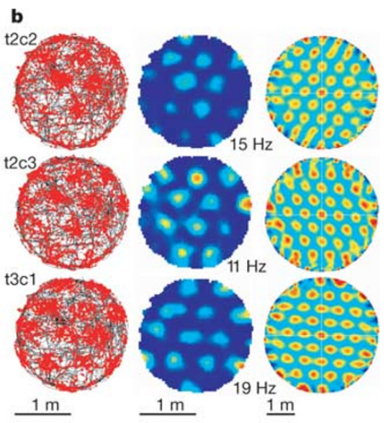
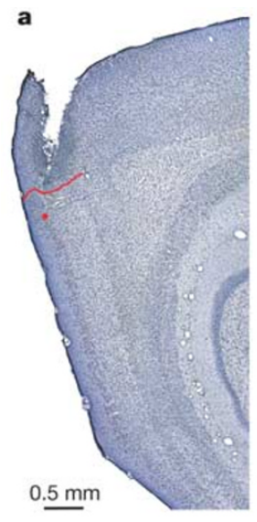
Entorhinal neurons fire at repeated spatial locations
A grid cell fires in multiple spatial fields arranged with approximately regular spacing. Hafting and colleagues recorded neurons in superficial dorsocaudal medial entorhinal cortex while rats explored a circular arena 2 m in diameter.
The larger arena exposed repeated fields that were difficult to recognize in smaller enclosures. Individual cells fired when the rat crossed separated locations distributed across the recording surface, rather than only one confined region.
A firing-rate map relates activity to position after accounting for time spent at each location. The repeated fields establish a periodic spatial code. They do not mean that the cortex contains a physically drawn lattice or that each neuron independently specifies one unique place.
Hafting et al. (2005), Fig. 1(b). Trajectories, rates and spatial autocorrelations.
Hafting et al. (2005), Fig. 1(a). Nissl-stained rat entorhinal recording site.
Hafting et al. (2005)
10
Notes:
• A **grid cell** fires in multiple spatial fields arranged with approximately regular spacing. Hafting and colleagues recorded neurons in superficial dorsocaudal medial entorhinal cortex while rats explored a circular arena 2 m in diameter.
• The larger arena exposed repeated fields that were difficult to recognize in smaller enclosures. Individual cells fired when the rat crossed separated locations distributed across the recording surface, rather than only one confined region.
• A firing-rate map relates activity to position after accounting for time spent at each location. The repeated fields establish a periodic spatial code. They do not mean that the cortex contains a physically drawn lattice or that each neuron independently specifies one unique place.
References:
Hafting T, Fyhn M, Molden S, Moser MB, Moser EI (2005). Microstructure of a spatial map in the entorhinal cortex. Nature 436(7052): 801–806. https://doi.org/10.1038/nature03721
Figure: Hafting et al. (2005), Fig. 1(b). Trajectories, rates and spatial autocorrelations.
Figure source: https://doi.org/10.1038/nature03721
Figure: Hafting et al. (2005), Fig. 1(a). Nissl-stained rat entorhinal recording site.
Figure source: https://doi.org/10.1038/nature03721

Slide 11
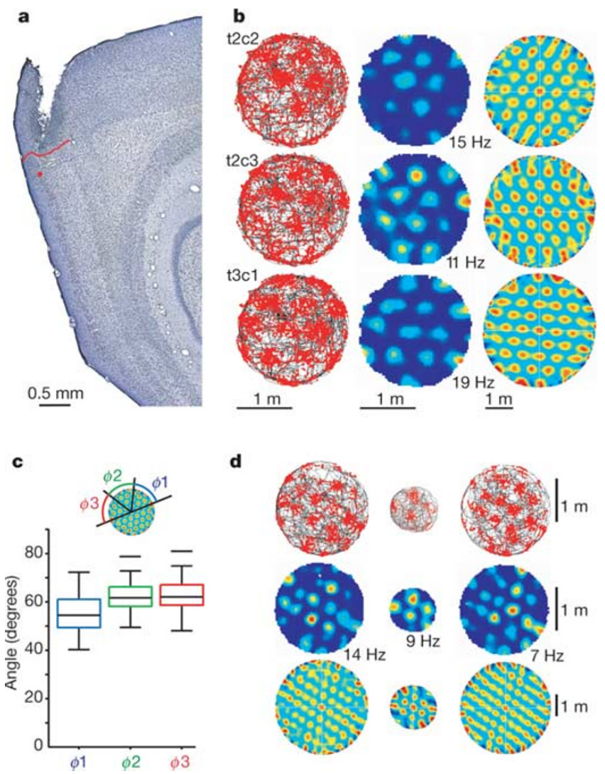
Histology locates the grid recordings in entorhinal cortex
Histology identifies tissue structure in thin stained brain sections. The recording location in Hafting and colleagues' example was in layer II of medial entorhinal cortex, near its border with postrhinal cortex.
A Nissl stain highlights neuronal cell bodies and allows cortical layers and regional boundaries to be recognized. Electrode positions were reconstructed from their tracks and the recorded progression of the microdrive, linking physiological measurements to anatomical location.
This reconstruction distinguishes an entorhinal recording from a hippocampal recording. It does not determine the molecular identity of every recorded cell. A spatial firing phenotype and an anatomical layer are measurable properties, but neither alone identifies the full synaptic circuit generating that phenotype.
Hafting et al. (2005), Fig. 1(a–d). Recording site and repeated spatial firing.
Hafting et al. (2005), Fig. 1(a). Nissl-stained rat entorhinal recording site.
Hafting et al. (2005)
11
Notes:
• **Histology** identifies tissue structure in thin stained brain sections. The recording location in Hafting and colleagues' example was in layer II of medial entorhinal cortex, near its border with postrhinal cortex.
• A Nissl stain highlights neuronal cell bodies and allows cortical layers and regional boundaries to be recognized. Electrode positions were reconstructed from their tracks and the recorded progression of the microdrive, linking physiological measurements to anatomical location.
• This reconstruction distinguishes an entorhinal recording from a hippocampal recording. It does not determine the molecular identity of every recorded cell. A spatial firing phenotype and an anatomical layer are measurable properties, but neither alone identifies the full synaptic circuit generating that phenotype.
References:
Hafting T, Fyhn M, Molden S, Moser MB, Moser EI (2005). Microstructure of a spatial map in the entorhinal cortex. Nature 436(7052): 801–806. https://doi.org/10.1038/nature03721
Figure: Hafting et al. (2005), Fig. 1(a–d). Recording site and repeated spatial firing.
Figure source: https://doi.org/10.1038/nature03721
Figure: Hafting et al. (2005), Fig. 1(a). Nissl-stained rat entorhinal recording site.
Figure source: https://doi.org/10.1038/nature03721

Slide 12
Rate maps separate firing from uneven exploration
Rats do not spend equal time at every point in an arena. A firing rate, measured in spikes per second or hertz, relates spike counts to the time available for spikes at each location.
Hafting and colleagues compared the animal's trajectory with spike locations and the corresponding rate map. Repeated regions of elevated rate remained after the spatial distribution of occupancy was incorporated into the analysis.
The comparison prevents a frequently visited region from being treated automatically as a high-response field. It still depends on adequate exploration: poorly sampled locations provide limited evidence about firing. A color-coded rate map represents measured neuronal activity, rather than a direct image of anatomical connections between spatial fields.
Hafting et al. (2005), Fig. 1(b). Trajectories, rates and spatial autocorrelations.
Hafting et al. (2005), Fig. 1(a). Nissl-stained rat entorhinal recording site.
Hafting et al. (2005)
12
Notes:
• Rats do not spend equal time at every point in an arena. A **firing rate**, measured in spikes per second or hertz, relates spike counts to the time available for spikes at each location.
• Hafting and colleagues compared the animal's trajectory with spike locations and the corresponding rate map. Repeated regions of elevated rate remained after the spatial distribution of occupancy was incorporated into the analysis.
• The comparison prevents a frequently visited region from being treated automatically as a high-response field. It still depends on adequate exploration: poorly sampled locations provide limited evidence about firing. A color-coded rate map represents measured neuronal activity, rather than a direct image of anatomical connections between spatial fields.
References:
Hafting T, Fyhn M, Molden S, Moser MB, Moser EI (2005). Microstructure of a spatial map in the entorhinal cortex. Nature 436(7052): 801–806. https://doi.org/10.1038/nature03721
Figure: Hafting et al. (2005), Fig. 1(b). Trajectories, rates and spatial autocorrelations.
Figure source: https://doi.org/10.1038/nature03721
Figure: Hafting et al. (2005), Fig. 1(a). Nissl-stained rat entorhinal recording site.
Figure source: https://doi.org/10.1038/nature03721

Slide 13
Spatial autocorrelation measures repeated grid structure
Spatial autocorrelation compares a rate map with shifted versions of itself. Similarity becomes high when the displacement aligns one set of firing fields with another, exposing repetition that may be less apparent from a single trajectory.
The central autocorrelation peak represents alignment without displacement. Six nearby peaks surrounded it, with directions separated by approximately 60°. That arrangement was consistent with firing locations at the vertices of an equilateral triangular lattice.
The analysis establishes regularity of the spatial pattern, rather than a mechanism that creates it. An autocorrelation map is also distinct from a temporal autocorrelation: the former compares spatial displacements, while the latter compares the timing of spikes.
Hafting et al. (2005), Fig. 1(b). Trajectories, rates and spatial autocorrelations.
Hafting et al. (2005), Fig. 1(a). Nissl-stained rat entorhinal recording site.
Hafting et al. (2005)
13
Notes:
• **Spatial autocorrelation** compares a rate map with shifted versions of itself. Similarity becomes high when the displacement aligns one set of firing fields with another, exposing repetition that may be less apparent from a single trajectory.
• The central autocorrelation peak represents alignment without displacement. Six nearby peaks surrounded it, with directions separated by approximately 60°. That arrangement was consistent with firing locations at the vertices of an equilateral triangular lattice.
• The analysis establishes regularity of the spatial pattern, rather than a mechanism that creates it. An autocorrelation map is also distinct from a temporal autocorrelation: the former compares spatial displacements, while the latter compares the timing of spikes.
References:
Hafting T, Fyhn M, Molden S, Moser MB, Moser EI (2005). Microstructure of a spatial map in the entorhinal cortex. Nature 436(7052): 801–806. https://doi.org/10.1038/nature03721
Figure: Hafting et al. (2005), Fig. 1(b). Trajectories, rates and spatial autocorrelations.
Figure source: https://doi.org/10.1038/nature03721
Figure: Hafting et al. (2005), Fig. 1(a). Nissl-stained rat entorhinal recording site.
Figure source: https://doi.org/10.1038/nature03721

Slide 14
Grid spacing specifies a distance between repeated fields
Grid spacing is the distance between neighboring repeated firing locations. Hafting and colleagues estimated spacing from the distances between the central autocorrelation peak and its nearest surrounding peaks.
Across the reported cells, spacing ranged from 39 to 73 cm. Within a cell, similar distances in several directions and approximately 60° angular separation supported a regular triangular pattern across the arena.
Spacing describes the spatial scale of a neuron's code, not the distance between neurons in brain tissue. Cells with different spacing can represent the same physical environment at different scales. The original observations did not establish whether those scales were selected continuously or organized into discrete functional modules.
Hafting et al. (2005), Fig. 1(b). Trajectories, rates and spatial autocorrelations.
Hafting et al. (2005), Fig. 1(a). Nissl-stained rat entorhinal recording site.
Hafting et al. (2005)
14
Notes:
• **Grid spacing** is the distance between neighboring repeated firing locations. Hafting and colleagues estimated spacing from the distances between the central autocorrelation peak and its nearest surrounding peaks.
• Across the reported cells, spacing ranged from 39 to 73 cm. Within a cell, similar distances in several directions and approximately 60° angular separation supported a regular triangular pattern across the arena.
• Spacing describes the spatial scale of a neuron's code, not the distance between neurons in brain tissue. Cells with different spacing can represent the same physical environment at different scales. The original observations did not establish whether those scales were selected continuously or organized into discrete functional modules.
References:
Hafting T, Fyhn M, Molden S, Moser MB, Moser EI (2005). Microstructure of a spatial map in the entorhinal cortex. Nature 436(7052): 801–806. https://doi.org/10.1038/nature03721
Figure: Hafting et al. (2005), Fig. 1(b). Trajectories, rates and spatial autocorrelations.
Figure source: https://doi.org/10.1038/nature03721
Figure: Hafting et al. (2005), Fig. 1(a). Nissl-stained rat entorhinal recording site.
Figure source: https://doi.org/10.1038/nature03721

Slide 15
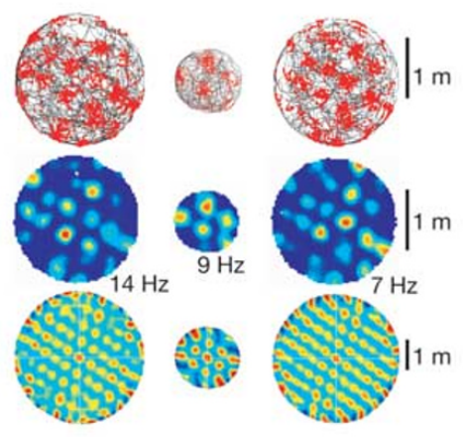
Arena expansion adds fields without matching the boundary
Hafting and colleagues recorded cells as animals moved between a large and a smaller circular enclosure and returned to the large enclosure. The repeated triangular organization remained recognizable across the changes in available surface.
The expanded arena contained more activity nodes, while their density remained similar. The pattern therefore was not simply a small fixed collection of fields stretched to match the enclosing walls.
The result supports a spatially repeated code that can extend across different recording areas. The authors discussed potentially unlimited grids, but finite experimental arenas cannot establish infinite extent. Boundaries and available sampling still limit which portions of a cell's spatial pattern can be observed.
Hafting et al. (2005), Fig. 1(d). Grid fields in large and small arenas.
Hafting et al. (2005), Fig. 1(a). Nissl-stained rat entorhinal recording site.
Hafting et al. (2005)
15
Notes:
• Hafting and colleagues recorded cells as animals moved between a large and a smaller circular enclosure and returned to the large enclosure. The repeated triangular organization remained recognizable across the changes in available surface.
• The expanded arena contained more activity nodes, while their density remained similar. The pattern therefore was not simply a small fixed collection of fields stretched to match the enclosing walls.
• The result supports a spatially repeated code that can extend across different recording areas. The authors discussed potentially unlimited grids, but finite experimental arenas cannot establish infinite extent. Boundaries and available sampling still limit which portions of a cell's spatial pattern can be observed.
References:
Hafting T, Fyhn M, Molden S, Moser MB, Moser EI (2005). Microstructure of a spatial map in the entorhinal cortex. Nature 436(7052): 801–806. https://doi.org/10.1038/nature03721
Figure: Hafting et al. (2005), Fig. 1(d). Grid fields in large and small arenas.
Figure source: https://doi.org/10.1038/nature03721
Figure: Hafting et al. (2005), Fig. 1(a). Nissl-stained rat entorhinal recording site.
Figure source: https://doi.org/10.1038/nature03721

Slide 16
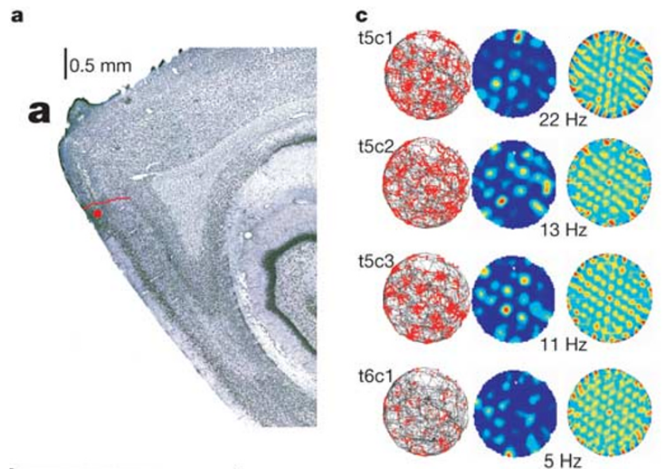
Nearby grid cells share orientation and spacing
Simultaneously recorded grid cells near the same electrode location had similar spacing and orientation. Orientation is the angle of the lattice relative to a reference direction in the recording environment.
Their rate maps contained repeated fields with a common geometry, even when the locations of individual fields differed. A tetrode, a bundle of four recording wires, helps separate neurons by comparing the amplitudes of their spikes on multiple channels.
Shared metric properties support coordination among nearby cells. They do not establish direct synaptic connections between every simultaneously recorded pair. Common input and local interactions are both possible explanations for coordinated geometry, and extracellular recordings alone do not distinguish them.
Hafting et al. (2005), Fig. 2(a,c). Rat recording site and dorsal grid fields.
Hafting et al. (2005), Fig. 1(a). Nissl-stained rat entorhinal recording site.
Hafting et al. (2005)
16
Notes:
• Simultaneously recorded grid cells near the same electrode location had similar spacing and orientation. **Orientation** is the angle of the lattice relative to a reference direction in the recording environment.
• Their rate maps contained repeated fields with a common geometry, even when the locations of individual fields differed. A **tetrode**, a bundle of four recording wires, helps separate neurons by comparing the amplitudes of their spikes on multiple channels.
• Shared metric properties support coordination among nearby cells. They do not establish direct synaptic connections between every simultaneously recorded pair. Common input and local interactions are both possible explanations for coordinated geometry, and extracellular recordings alone do not distinguish them.
References:
Hafting T, Fyhn M, Molden S, Moser MB, Moser EI (2005). Microstructure of a spatial map in the entorhinal cortex. Nature 436(7052): 801–806. https://doi.org/10.1038/nature03721
Figure: Hafting et al. (2005), Fig. 2(a,c). Rat recording site and dorsal grid fields.
Figure source: https://doi.org/10.1038/nature03721
Figure: Hafting et al. (2005), Fig. 1(a). Nissl-stained rat entorhinal recording site.
Figure source: https://doi.org/10.1038/nature03721

Slide 17
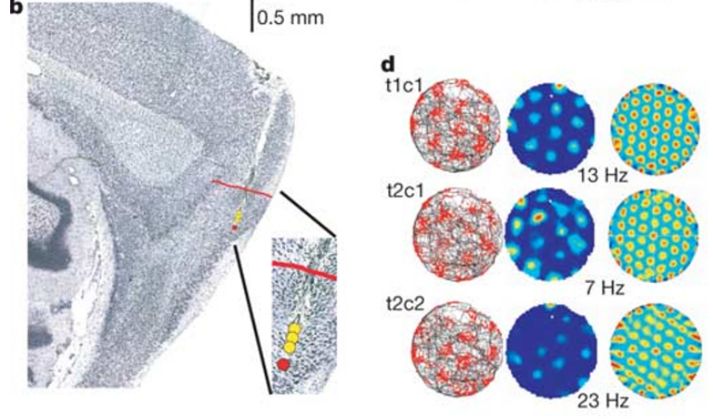
Ventral recording sites have wider grid spacing
Dorsal and ventral describe positions along the anatomical axis used to compare recording sites. In the same rat, one site near the dorsal entorhinal border had denser grid spacing than a site 560 µm deeper.
Reported spacing was 39.1–43.0 cm at the dorsal location and 48.1–52.2 cm at the more ventral location. Comparing sites within one animal reduced explanations based entirely on differences between animals or their environments.
The finding links anatomical position to the spatial scale of firing. It does not mean that the same neuron changed scale solely because an electrode moved. The recordings sampled different cells at different positions, revealing an organized relationship across the tissue.
Hafting et al. (2005), Fig. 2(b,d). Ventral recording site and grid fields.
Hafting et al. (2005), Fig. 1(a). Nissl-stained rat entorhinal recording site.
Hafting et al. (2005)
17
Notes:
• **Dorsal** and **ventral** describe positions along the anatomical axis used to compare recording sites. In the same rat, one site near the dorsal entorhinal border had denser grid spacing than a site 560 µm deeper.
• Reported spacing was 39.1–43.0 cm at the dorsal location and 48.1–52.2 cm at the more ventral location. Comparing sites within one animal reduced explanations based entirely on differences between animals or their environments.
• The finding links anatomical position to the spatial scale of firing. It does not mean that the same neuron changed scale solely because an electrode moved. The recordings sampled different cells at different positions, revealing an organized relationship across the tissue.
References:
Hafting T, Fyhn M, Molden S, Moser MB, Moser EI (2005). Microstructure of a spatial map in the entorhinal cortex. Nature 436(7052): 801–806. https://doi.org/10.1038/nature03721
Figure: Hafting et al. (2005), Fig. 2(b,d). Ventral recording site and grid fields.
Figure source: https://doi.org/10.1038/nature03721
Figure: Hafting et al. (2005), Fig. 1(a). Nissl-stained rat entorhinal recording site.
Figure source: https://doi.org/10.1038/nature03721

Slide 18
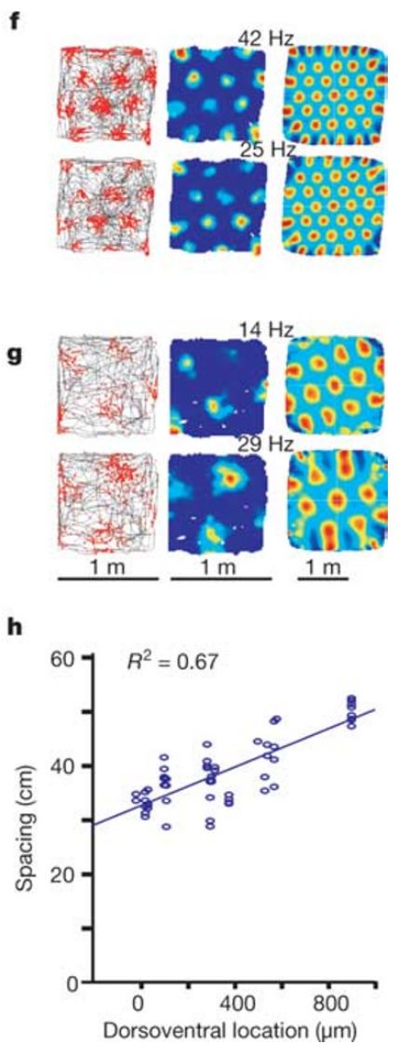
Grid field size increases with the spatial scale
A firing field is a region where a cell's rate exceeds the surrounding background under the tested conditions. Hafting and colleagues measured field size from the central peak of the spatial autocorrelation.
More ventral recording positions were associated with both greater spacing and larger individual fields. These are related but distinct properties: spacing concerns separation between fields, whereas field size concerns the extent of each field.
Their joint increase produces a coarser spatial pattern, rather than merely moving unchanged fields farther apart. The measurements depend on the stated analysis threshold. Field size is therefore an operational measurement of an activity pattern, not an anatomical boundary visible in the entorhinal tissue.
Hafting et al. (2005), Fig. 2(f–h). Recording depth and spatial scale.
Hafting et al. (2005), Fig. 1(a). Nissl-stained rat entorhinal recording site.
Hafting et al. (2005)
18
Notes:
• A **firing field** is a region where a cell's rate exceeds the surrounding background under the tested conditions. Hafting and colleagues measured field size from the central peak of the spatial autocorrelation.
• More ventral recording positions were associated with both greater spacing and larger individual fields. These are related but distinct properties: spacing concerns separation between fields, whereas field size concerns the extent of each field.
• Their joint increase produces a coarser spatial pattern, rather than merely moving unchanged fields farther apart. The measurements depend on the stated analysis threshold. Field size is therefore an operational measurement of an activity pattern, not an anatomical boundary visible in the entorhinal tissue.
References:
Hafting T, Fyhn M, Molden S, Moser MB, Moser EI (2005). Microstructure of a spatial map in the entorhinal cortex. Nature 436(7052): 801–806. https://doi.org/10.1038/nature03721
Figure: Hafting et al. (2005), Fig. 2(f–h). Recording depth and spatial scale.
Figure source: https://doi.org/10.1038/nature03721
Figure: Hafting et al. (2005), Fig. 1(a). Nissl-stained rat entorhinal recording site.
Figure source: https://doi.org/10.1038/nature03721

Slide 19
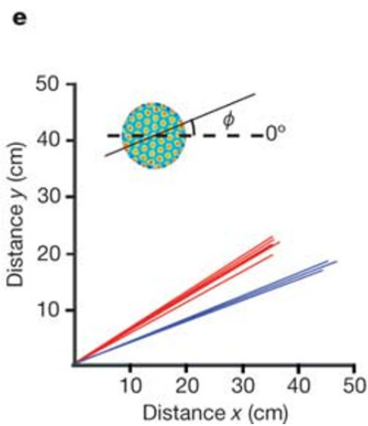
Grid orientation is distinct from the scale gradient
The angle of a grid can differ between recording locations even when nearby cells at each location share similar orientation. Hafting and colleagues defined that angle relative to a camera-based reference direction.
Spacing and field size increased toward ventral locations, but orientation did not exhibit the same systematic dorsal-to-ventral relationship. Spatial scale and directional alignment therefore must be treated as separate properties of the code.
A change in angle rotates a lattice without necessarily changing the distance between its fields. A change in spacing alters the metric scale without necessarily rotating it. Separating these variables prevents a shift in directional reference from being mistaken for a change in spatial resolution.
Hafting et al. (2005), Fig. 2(e). Grid spacing and orientation at two sites.
Hafting et al. (2005), Fig. 1(a). Nissl-stained rat entorhinal recording site.
Hafting et al. (2005)
19
Notes:
• The angle of a grid can differ between recording locations even when nearby cells at each location share similar orientation. Hafting and colleagues defined that angle relative to a camera-based reference direction.
• Spacing and field size increased toward ventral locations, but orientation did not exhibit the same systematic dorsal-to-ventral relationship. Spatial scale and directional alignment therefore must be treated as separate properties of the code.
• A change in angle rotates a lattice without necessarily changing the distance between its fields. A change in spacing alters the metric scale without necessarily rotating it. Separating these variables prevents a shift in directional reference from being mistaken for a change in spatial resolution.
References:
Hafting T, Fyhn M, Molden S, Moser MB, Moser EI (2005). Microstructure of a spatial map in the entorhinal cortex. Nature 436(7052): 801–806. https://doi.org/10.1038/nature03721
Figure: Hafting et al. (2005), Fig. 2(e). Grid spacing and orientation at two sites.
Figure source: https://doi.org/10.1038/nature03721
Figure: Hafting et al. (2005), Fig. 1(a). Nissl-stained rat entorhinal recording site.
Figure source: https://doi.org/10.1038/nature03721

Slide 20
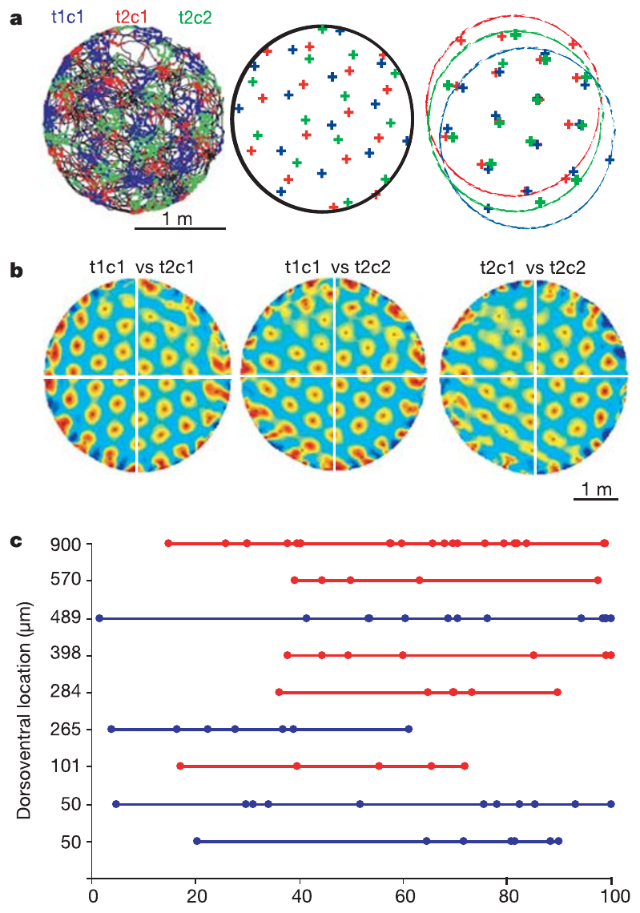
Grid phase differs among neighboring neurons
Spatial phase describes where the vertices of a grid lie relative to a reference location. Nearby neurons can share spacing and orientation while placing their elevated firing fields at different positions.
Hafting and colleagues compared simultaneously recorded rate maps and found displaced versions of similar lattices. Superimposing the patterns after a spatial shift brought their vertices into closer alignment.
Different phases allow neighboring cells to become active at different positions, collectively covering more of the environment than a single cell. Phase is a spatial displacement here, not the timing of a spike relative to an oscillation. These two uses of the word refer to different measurements.
Hafting et al. (2005), Fig. 3(a–c). Spatial phases of neighboring grid cells.
Hafting et al. (2005), Fig. 1(a). Nissl-stained rat entorhinal recording site.
Hafting et al. (2005)
20
Notes:
• **Spatial phase** describes where the vertices of a grid lie relative to a reference location. Nearby neurons can share spacing and orientation while placing their elevated firing fields at different positions.
• Hafting and colleagues compared simultaneously recorded rate maps and found displaced versions of similar lattices. Superimposing the patterns after a spatial shift brought their vertices into closer alignment.
• Different phases allow neighboring cells to become active at different positions, collectively covering more of the environment than a single cell. Phase is a spatial displacement here, not the timing of a spike relative to an oscillation. These two uses of the word refer to different measurements.
References:
Hafting T, Fyhn M, Molden S, Moser MB, Moser EI (2005). Microstructure of a spatial map in the entorhinal cortex. Nature 436(7052): 801–806. https://doi.org/10.1038/nature03721
Figure: Hafting et al. (2005), Fig. 3(a–c). Spatial phases of neighboring grid cells.
Figure source: https://doi.org/10.1038/nature03721
Figure: Hafting et al. (2005), Fig. 1(a). Nissl-stained rat entorhinal recording site.
Figure source: https://doi.org/10.1038/nature03721

Slide 21
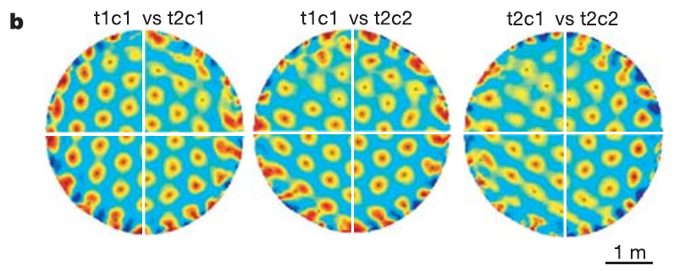
Cross-correlation compares the phase of two cells
Spatial cross-correlation compares the rate maps of two different neurons as one map is shifted relative to the other. Peaks indicate displacements that bring their firing patterns into alignment.
For neighboring grid cells, the cross-correlation retained a repeated arrangement but commonly placed its nearest peak away from the origin. That offset quantified a difference in spatial phase despite shared spacing and orientation.
Cells at different recording locations could have different scales and orientations, producing less sharply aligned cross-correlations. The comparison measures similarity of spatial codes, not communication between the neurons. A correlated pattern can arise through common inputs without a direct synapse between the recorded cells.
Hafting et al. (2005), Fig. 3(b). Spatial cross-correlations of neighboring cells.
Hafting et al. (2005), Fig. 1(a). Nissl-stained rat entorhinal recording site.
Hafting et al. (2005)
21
Notes:
• **Spatial cross-correlation** compares the rate maps of two different neurons as one map is shifted relative to the other. Peaks indicate displacements that bring their firing patterns into alignment.
• For neighboring grid cells, the cross-correlation retained a repeated arrangement but commonly placed its nearest peak away from the origin. That offset quantified a difference in spatial phase despite shared spacing and orientation.
• Cells at different recording locations could have different scales and orientations, producing less sharply aligned cross-correlations. The comparison measures similarity of spatial codes, not communication between the neurons. A correlated pattern can arise through common inputs without a direct synapse between the recorded cells.
References:
Hafting T, Fyhn M, Molden S, Moser MB, Moser EI (2005). Microstructure of a spatial map in the entorhinal cortex. Nature 436(7052): 801–806. https://doi.org/10.1038/nature03721
Figure: Hafting et al. (2005), Fig. 3(b). Spatial cross-correlations of neighboring cells.
Figure source: https://doi.org/10.1038/nature03721
Figure: Hafting et al. (2005), Fig. 1(a). Nissl-stained rat entorhinal recording site.
Figure source: https://doi.org/10.1038/nature03721

Slide 22
Different phases distribute activity across the arena
A grid cell's periodic firing leaves locations where that particular cell is relatively inactive. Neighboring cells with different spatial phases place their fields in other regions while retaining similar metric properties.
The recorded population collectively covered the arena because field locations differed across cells. The observed phase differences were distributed across the available range rather than restricted to a single common alignment.
Population coverage supports a code for location using combinations of active neurons. It does not establish that every location has a unique code in an arbitrarily large environment: periodic activity can repeat. Additional scales, starting-position information, or other inputs may be required to resolve such ambiguity.
Hafting et al. (2005), Fig. 3(a–c). Spatial phases of neighboring grid cells.
Hafting et al. (2005), Fig. 1(a). Nissl-stained rat entorhinal recording site.
Hafting et al. (2005)
22
Notes:
• A grid cell's periodic firing leaves locations where that particular cell is relatively inactive. Neighboring cells with different spatial phases place their fields in other regions while retaining similar metric properties.
• The recorded population collectively covered the arena because field locations differed across cells. The observed phase differences were distributed across the available range rather than restricted to a single common alignment.
• Population coverage supports a code for location using combinations of active neurons. It does not establish that every location has a unique code in an arbitrarily large environment: periodic activity can repeat. Additional scales, starting-position information, or other inputs may be required to resolve such ambiguity.
References:
Hafting T, Fyhn M, Molden S, Moser MB, Moser EI (2005). Microstructure of a spatial map in the entorhinal cortex. Nature 436(7052): 801–806. https://doi.org/10.1038/nature03721
Figure: Hafting et al. (2005), Fig. 3(a–c). Spatial phases of neighboring grid cells.
Figure source: https://doi.org/10.1038/nature03721
Figure: Hafting et al. (2005), Fig. 1(a). Nissl-stained rat entorhinal recording site.
Figure source: https://doi.org/10.1038/nature03721

Slide 23
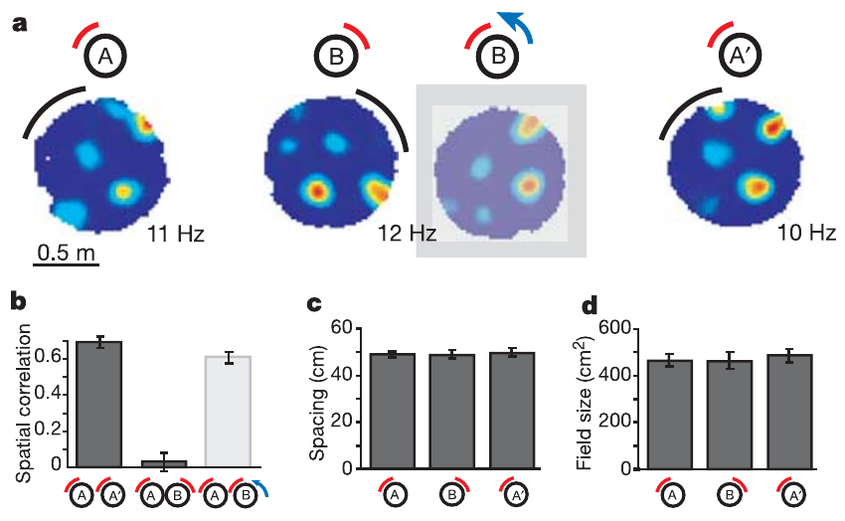
Landmark rotation rotates the grid's reference frame
An external landmark is an environmental feature that can supply a stable spatial reference. Hafting and colleagues rotated a cue card by 90° and compared the grid before, during, and after the manipulation.
Grid orientation changed with the cue, while the periodic organization was retained. Returning the card toward its original position restored the corresponding alignment, supporting control of the grid's directional reference by a visible environmental feature.
The result distinguishes the existence of periodic firing from its alignment to a particular room. It does not establish that vision generates the periodicity itself. The same lattice can retain its geometry while external cues determine how that lattice is oriented in the environment.
Hafting et al. (2005), Fig. 4(a–d). Grid alignment during cue-card rotation.
Hafting et al. (2005), Fig. 1(a). Nissl-stained rat entorhinal recording site.
Hafting et al. (2005)
23
Notes:
• An **external landmark** is an environmental feature that can supply a stable spatial reference. Hafting and colleagues rotated a cue card by 90° and compared the grid before, during, and after the manipulation.
• Grid orientation changed with the cue, while the periodic organization was retained. Returning the card toward its original position restored the corresponding alignment, supporting control of the grid's directional reference by a visible environmental feature.
• The result distinguishes the existence of periodic firing from its alignment to a particular room. It does not establish that vision generates the periodicity itself. The same lattice can retain its geometry while external cues determine how that lattice is oriented in the environment.
References:
Hafting T, Fyhn M, Molden S, Moser MB, Moser EI (2005). Microstructure of a spatial map in the entorhinal cortex. Nature 436(7052): 801–806. https://doi.org/10.1038/nature03721
Figure: Hafting et al. (2005), Fig. 4(a–d). Grid alignment during cue-card rotation.
Figure source: https://doi.org/10.1038/nature03721
Figure: Hafting et al. (2005), Fig. 1(a). Nissl-stained rat entorhinal recording site.
Figure source: https://doi.org/10.1038/nature03721

Slide 24
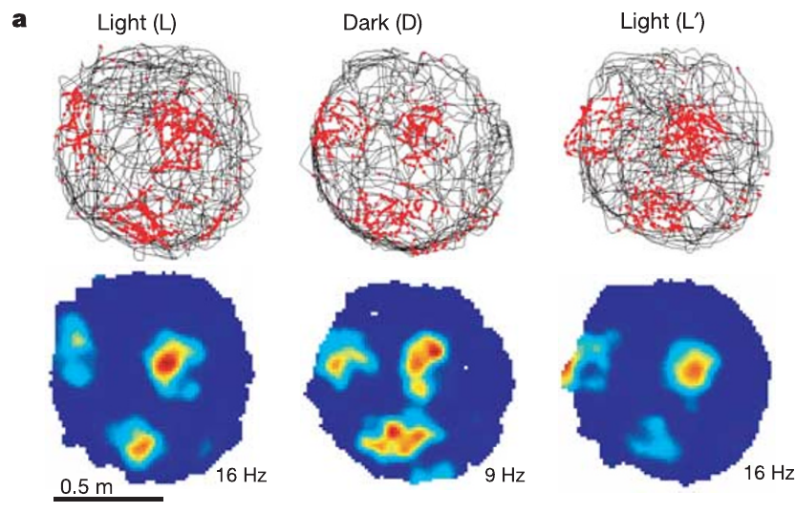
Grid periodicity persists when the lights go off
Hafting and colleagues recorded a grid cell during 10 min of light, 10 min of darkness, and a return to light. The animal remained in the recording environment during these changes.
The grid pattern persisted in darkness, although fields could become somewhat dispersed or displaced. Self-motion information comprises signals related to the animal's own movement, which remain available even when visual landmarks are absent.
Persistence without vision is consistent with movement-based updating of location. Darkness does not remove every external cue: odors, touch, and environmental boundaries can remain available. The experiment therefore supports a contribution from self-motion without proving that the grid operates independently of all environmental information.
Hafting et al. (2005), Fig. 5(a). Trajectory and rate maps across light conditions.
Hafting et al. (2005), Fig. 1(a). Nissl-stained rat entorhinal recording site.
Hafting et al. (2005)
24
Notes:
• Hafting and colleagues recorded a grid cell during 10 min of light, 10 min of darkness, and a return to light. The animal remained in the recording environment during these changes.
• The grid pattern persisted in darkness, although fields could become somewhat dispersed or displaced. **Self-motion information** comprises signals related to the animal's own movement, which remain available even when visual landmarks are absent.
• Persistence without vision is consistent with movement-based updating of location. Darkness does not remove every external cue: odors, touch, and environmental boundaries can remain available. The experiment therefore supports a contribution from self-motion without proving that the grid operates independently of all environmental information.
References:
Hafting T, Fyhn M, Molden S, Moser MB, Moser EI (2005). Microstructure of a spatial map in the entorhinal cortex. Nature 436(7052): 801–806. https://doi.org/10.1038/nature03721
Figure: Hafting et al. (2005), Fig. 5(a). Trajectory and rate maps across light conditions.
Figure source: https://doi.org/10.1038/nature03721
Figure: Hafting et al. (2005), Fig. 1(a). Nissl-stained rat entorhinal recording site.
Figure source: https://doi.org/10.1038/nature03721

Slide 25
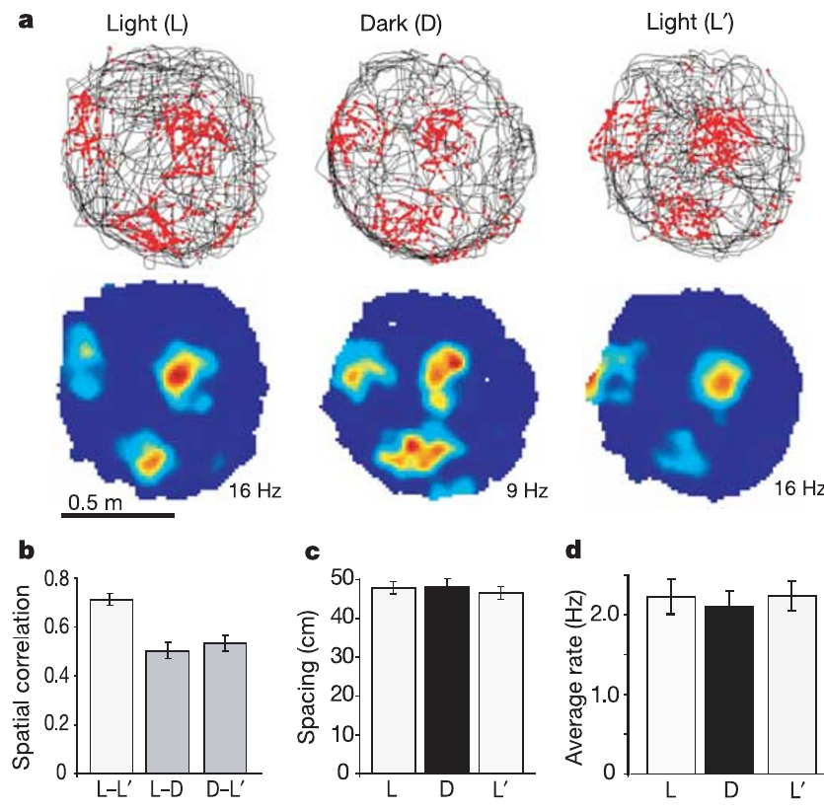
Path integration remains a supported mechanism
Path integration updates an estimate of location from movement since a reference position. A spatial code that persists in darkness is compatible with this computation because movement information can continue to update the estimate.
Hafting and colleagues found no major change in grid spacing during visual deprivation. The preserved metric pattern contrasted with the ability of visible landmarks to change the grid's directional alignment.
The combination supports a distinction between internally maintained geometry and external calibration. The recordings did not directly measure all movement signals or selectively remove them. Path integration was consequently a supported explanation of grid function, rather than a fully identified sequence of synaptic transformations established by the experiment.
Hafting et al. (2005), Fig. 5(a–d). Grid activity during light and darkness.
Hafting et al. (2005), Fig. 1(a). Nissl-stained rat entorhinal recording site.
Hafting et al. (2005)
25
Notes:
• **Path integration** updates an estimate of location from movement since a reference position. A spatial code that persists in darkness is compatible with this computation because movement information can continue to update the estimate.
• Hafting and colleagues found no major change in grid spacing during visual deprivation. The preserved metric pattern contrasted with the ability of visible landmarks to change the grid's directional alignment.
• The combination supports a distinction between internally maintained geometry and external calibration. The recordings did not directly measure all movement signals or selectively remove them. Path integration was consequently a supported explanation of grid function, rather than a fully identified sequence of synaptic transformations established by the experiment.
References:
Hafting T, Fyhn M, Molden S, Moser MB, Moser EI (2005). Microstructure of a spatial map in the entorhinal cortex. Nature 436(7052): 801–806. https://doi.org/10.1038/nature03721
Figure: Hafting et al. (2005), Fig. 5(a–d). Grid activity during light and darkness.
Figure source: https://doi.org/10.1038/nature03721
Figure: Hafting et al. (2005), Fig. 1(a). Nissl-stained rat entorhinal recording site.
Figure source: https://doi.org/10.1038/nature03721

Slide 26
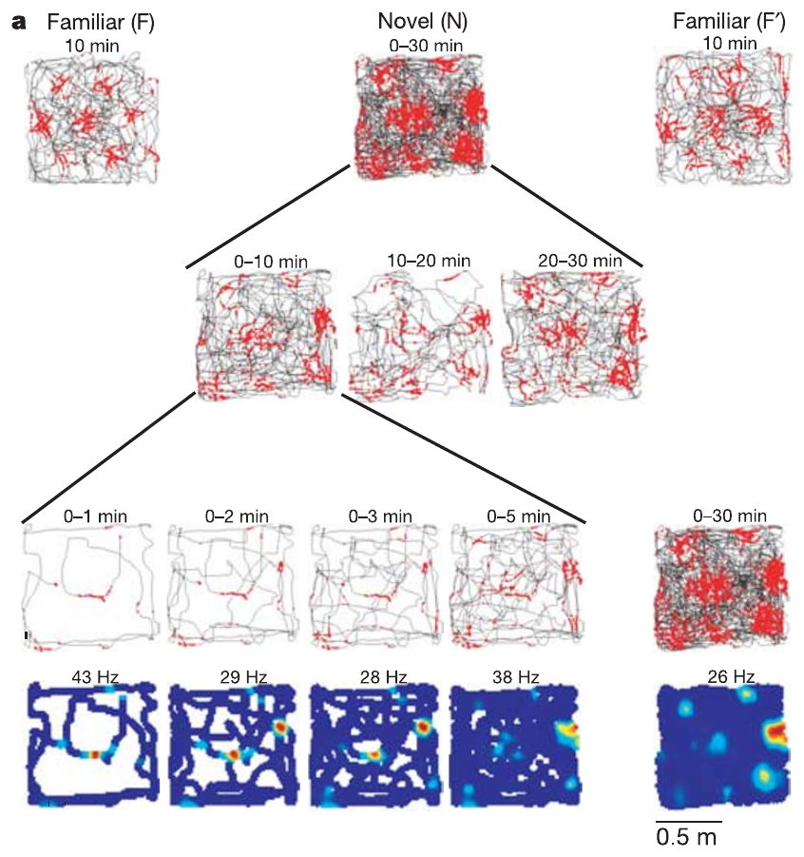
Grid structure appears rapidly in a novel room
The animals were tested in a familiar room, a novel room, and the familiar room again. Repeated firing fields were present early in the novel environment, rather than appearing only after prolonged experience with that particular room.
Hafting and colleagues divided the novel-room trial into short blocks. Activity during the first 2 min already related to the spatial pattern measured near the end of the trial, while the pattern became more stable with exposure.
Rapid expression supports transfer of a spatial organizing process across environments. It does not mean that landmark associations are already complete on entry. An available grid geometry and the stabilization of its alignment are separate aspects of the response.
Hafting et al. (2005), Fig. 6(a). Spatial firing during novel-room exposure.
Hafting et al. (2005), Fig. 1(a). Nissl-stained rat entorhinal recording site.
Hafting et al. (2005)
26
Notes:
• The animals were tested in a familiar room, a novel room, and the familiar room again. Repeated firing fields were present early in the novel environment, rather than appearing only after prolonged experience with that particular room.
• Hafting and colleagues divided the novel-room trial into short blocks. Activity during the first 2 min already related to the spatial pattern measured near the end of the trial, while the pattern became more stable with exposure.
• Rapid expression supports transfer of a spatial organizing process across environments. It does not mean that landmark associations are already complete on entry. An available grid geometry and the stabilization of its alignment are separate aspects of the response.
References:
Hafting T, Fyhn M, Molden S, Moser MB, Moser EI (2005). Microstructure of a spatial map in the entorhinal cortex. Nature 436(7052): 801–806. https://doi.org/10.1038/nature03721
Figure: Hafting et al. (2005), Fig. 6(a). Spatial firing during novel-room exposure.
Figure source: https://doi.org/10.1038/nature03721
Figure: Hafting et al. (2005), Fig. 1(a). Nissl-stained rat entorhinal recording site.
Figure source: https://doi.org/10.1038/nature03721

Slide 27
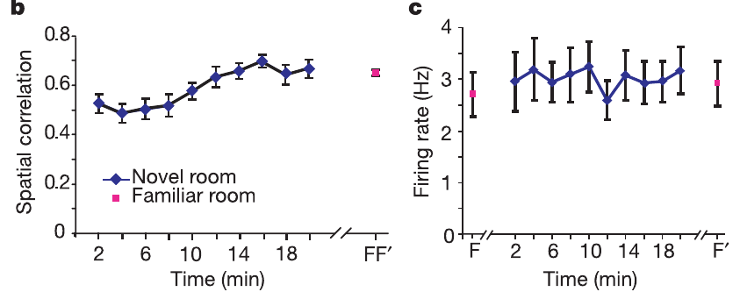
Experience stabilizes alignment without creating the lattice
The novel-room rate maps became more consistent during continued exploration. Stability was measured by comparing firing at corresponding locations during earlier portions of a trial and its final portion.
The grid's orientation also differed between the familiar and novel rooms, while repeated familiar-room tests had much smaller changes. The same spatial organizing principle could therefore be expressed with room-specific alignment.
The authors proposed that learning establishes associations between landmarks and the grid's phase and orientation. That proposal accounts for gradual stabilization but does not identify a particular plasticity receptor or synapse. The study measured changes in spatial activity, not the molecular events that stored those associations.
Hafting et al. (2005), Fig. 6(b,c). Rate-map stabilization across exploration.
Hafting et al. (2005), Fig. 1(a). Nissl-stained rat entorhinal recording site.
Hafting et al. (2005)
27
Notes:
• The novel-room rate maps became more consistent during continued exploration. Stability was measured by comparing firing at corresponding locations during earlier portions of a trial and its final portion.
• The grid's orientation also differed between the familiar and novel rooms, while repeated familiar-room tests had much smaller changes. The same spatial organizing principle could therefore be expressed with room-specific alignment.
• The authors proposed that learning establishes associations between landmarks and the grid's phase and orientation. That proposal accounts for gradual stabilization but does not identify a particular plasticity receptor or synapse. The study measured changes in spatial activity, not the molecular events that stored those associations.
References:
Hafting T, Fyhn M, Molden S, Moser MB, Moser EI (2005). Microstructure of a spatial map in the entorhinal cortex. Nature 436(7052): 801–806. https://doi.org/10.1038/nature03721
Figure: Hafting et al. (2005), Fig. 6(b,c). Rate-map stabilization across exploration.
Figure source: https://doi.org/10.1038/nature03721
Figure: Hafting et al. (2005), Fig. 1(a). Nissl-stained rat entorhinal recording site.
Figure source: https://doi.org/10.1038/nature03721

Slide 28
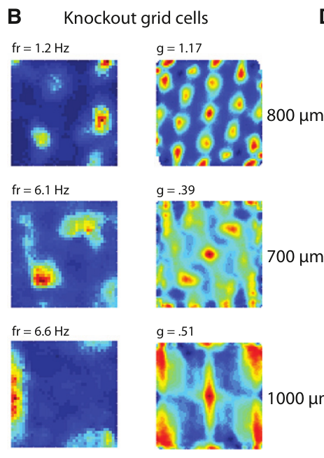
HCN1 deletion tests a cellular contribution to grid scale
Giocomo and colleagues tested whether an ion-channel protein contributes to spatial scale by recording grid cells in mice with forebrain-restricted HCN1 knockout. A knockout removes functional expression of the targeted gene in the affected tissue.
Littermate controls provided a comparison for the genetic manipulation, and experimenters remained unaware of group identity during collection and preliminary analysis. Recordings sampled superficial medial entorhinal cortex while mice explored open fields.
The intervention moved beyond observing a scale gradient to altering a candidate molecular contributor. Because the deletion affected the forebrain rather than only recorded grid cells, the results cannot be assigned exclusively to a cell-autonomous action of HCN1 within each recorded neuron.
Giocomo et al. (2011), Fig. 3(A, upper histology). Mouse sagittal brain section and entorhinal recording location.
Giocomo et al. (2011), Fig. 1(B). Grid-cell patterns after HCN1 knockout.
Giocomo et al. (2011)
28
Notes:
• Giocomo and colleagues tested whether an ion-channel protein contributes to spatial scale by recording grid cells in mice with forebrain-restricted **HCN1 knockout**. A knockout removes functional expression of the targeted gene in the affected tissue.
• Littermate controls provided a comparison for the genetic manipulation, and experimenters remained unaware of group identity during collection and preliminary analysis. Recordings sampled superficial medial entorhinal cortex while mice explored open fields.
• The intervention moved beyond observing a scale gradient to altering a candidate molecular contributor. Because the deletion affected the forebrain rather than only recorded grid cells, the results cannot be assigned exclusively to a cell-autonomous action of HCN1 within each recorded neuron.
References:
Giocomo LM, Hussaini SA, Zheng F, Kandel ER, Moser MB, Moser EI (2011). Grid cells use HCN1 channels for spatial scaling. Cell 147(5): 1159–1170. https://doi.org/10.1016/j.cell.2011.08.051
Figure: Giocomo et al. (2011), Fig. 1(B). Grid-cell patterns after HCN1 knockout.
Figure source: https://doi.org/10.1016/j.cell.2011.08.051
Figure: Giocomo et al. (2011), Fig. 3(A, upper histology). Mouse sagittal brain section and entorhinal recording location.
Figure source: https://doi.org/10.1016/j.cell.2011.08.051

Slide 29
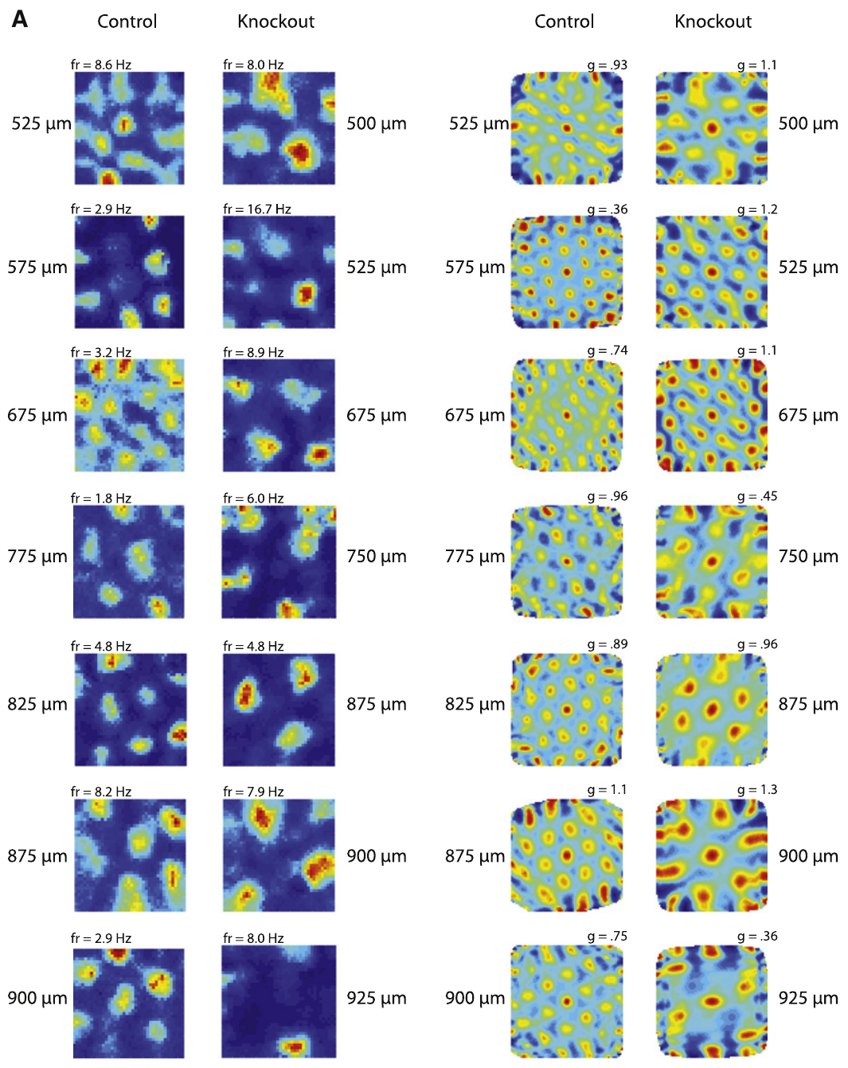
HCN channels influence how neurons integrate input
HCN denotes hyperpolarization-activated cyclic nucleotide-gated channels. These channels conduct the inward cation current called Ih and influence membrane responses and the time over which inputs can interact.
Giocomo and colleagues used prior cellular evidence that reducing HCN1 slows resonance and temporal integration in entorhinal layer II cells as the rationale for recording spatial activity after forebrain deletion. Temporal integration is the combination of inputs arriving at different times.
The knockout grid maps connect the channel intervention to altered spatial firing. They do not directly measure Ih in the same recorded grid cells. The relationship between membrane integration and the movement-to-space transformation remains a mechanistic interpretation constrained by the observed changes in scale.
Giocomo et al. (2011), Fig. 3(A, upper histology). Mouse sagittal brain section and entorhinal recording location.
Giocomo et al. (2011), Fig. 2(A). Grid patterns at several recording depths.
Giocomo et al. (2011)
29
Notes:
• **HCN** denotes hyperpolarization-activated cyclic nucleotide-gated channels. These channels conduct the inward cation current called **Ih** and influence membrane responses and the time over which inputs can interact.
• Giocomo and colleagues used prior cellular evidence that reducing HCN1 slows resonance and temporal integration in entorhinal layer II cells as the rationale for recording spatial activity after forebrain deletion. **Temporal integration** is the combination of inputs arriving at different times.
• The knockout grid maps connect the channel intervention to altered spatial firing. They do not directly measure Ih in the same recorded grid cells. The relationship between membrane integration and the movement-to-space transformation remains a mechanistic interpretation constrained by the observed changes in scale.
References:
Giocomo LM, Hussaini SA, Zheng F, Kandel ER, Moser MB, Moser EI (2011). Grid cells use HCN1 channels for spatial scaling. Cell 147(5): 1159–1170. https://doi.org/10.1016/j.cell.2011.08.051
Figure: Giocomo et al. (2011), Fig. 2(A). Grid patterns at several recording depths.
Figure source: https://doi.org/10.1016/j.cell.2011.08.051
Figure: Giocomo et al. (2011), Fig. 3(A, upper histology). Mouse sagittal brain section and entorhinal recording location.
Figure source: https://doi.org/10.1016/j.cell.2011.08.051

Slide 30
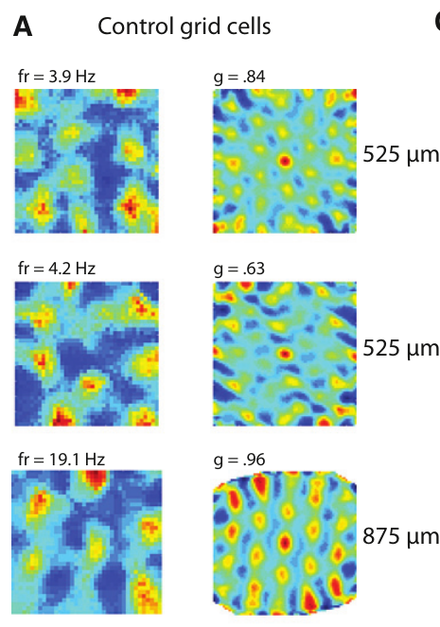
A large open field reveals the knockout grid pattern
Mice explored a 100 × 100 cm box and, in additional sessions, a 50 × 50 cm box. The larger environment provided sufficient extent to recognize repeated fields over the sampled dorsal-to-ventral recording range.
The smaller box supported measurements of boundary-related and head-direction activity, but did not reveal every grid's full periodicity. The researchers consequently based the principal grid-cell comparison on recordings from the larger environment.
Arena dimensions determine how much of a spatial pattern can be sampled. Failure to recognize a lattice in a small box does not establish that a neuron lacks periodic activity. This control is particularly relevant when a manipulation enlarges spacing and reduces the number of visible fields.
Giocomo et al. (2011), Fig. 3(A, upper histology). Mouse sagittal brain section and entorhinal recording location.
Giocomo et al. (2011), Fig. 1(A). Control grid-cell rates and autocorrelations.
Giocomo et al. (2011)
30
Notes:
• Mice explored a 100 × 100 cm box and, in additional sessions, a 50 × 50 cm box. The larger environment provided sufficient extent to recognize repeated fields over the sampled dorsal-to-ventral recording range.
• The smaller box supported measurements of boundary-related and head-direction activity, but did not reveal every grid's full periodicity. The researchers consequently based the principal grid-cell comparison on recordings from the larger environment.
• Arena dimensions determine how much of a spatial pattern can be sampled. Failure to recognize a lattice in a small box does not establish that a neuron lacks periodic activity. This control is particularly relevant when a manipulation enlarges spacing and reduces the number of visible fields.
References:
Giocomo LM, Hussaini SA, Zheng F, Kandel ER, Moser MB, Moser EI (2011). Grid cells use HCN1 channels for spatial scaling. Cell 147(5): 1159–1170. https://doi.org/10.1016/j.cell.2011.08.051
Figure: Giocomo et al. (2011), Fig. 1(A). Control grid-cell rates and autocorrelations.
Figure source: https://doi.org/10.1016/j.cell.2011.08.051
Figure: Giocomo et al. (2011), Fig. 3(A, upper histology). Mouse sagittal brain section and entorhinal recording location.
Figure source: https://doi.org/10.1016/j.cell.2011.08.051

Slide 31
HCN1 knockout preserves periodic grid firing
Grid cells remained present after forebrain HCN1 deletion. Their rate maps and spatial autocorrelations retained repeated, approximately hexagonal organization, establishing that HCN1 was not required for every expression of the grid pattern.
Giocomo and colleagues compared observed spatial patterns with patterns obtained by shifting spike timing relative to the animal's path. This shuffle control preserves the spike sequence while disrupting its original association with position.
Preserved periodicity separates generation of grid-like structure from regulation of its scale. The result does not establish that Ih has no contribution to the network: other HCN subunits, other intrinsic currents, and circuit interactions can remain after removal of HCN1.
Giocomo et al. (2011), Fig. 3(A, upper histology). Mouse sagittal brain section and entorhinal recording location.
Giocomo et al. (2011), Fig. 1(B). Grid-cell patterns after HCN1 knockout.
Giocomo et al. (2011)
31
Notes:
• Grid cells remained present after forebrain HCN1 deletion. Their rate maps and spatial autocorrelations retained repeated, approximately hexagonal organization, establishing that HCN1 was not required for every expression of the grid pattern.
• Giocomo and colleagues compared observed spatial patterns with patterns obtained by shifting spike timing relative to the animal's path. This **shuffle control** preserves the spike sequence while disrupting its original association with position.
• Preserved periodicity separates generation of grid-like structure from regulation of its scale. The result does not establish that Ih has no contribution to the network: other HCN subunits, other intrinsic currents, and circuit interactions can remain after removal of HCN1.
References:
Giocomo LM, Hussaini SA, Zheng F, Kandel ER, Moser MB, Moser EI (2011). Grid cells use HCN1 channels for spatial scaling. Cell 147(5): 1159–1170. https://doi.org/10.1016/j.cell.2011.08.051
Figure: Giocomo et al. (2011), Fig. 1(B). Grid-cell patterns after HCN1 knockout.
Figure source: https://doi.org/10.1016/j.cell.2011.08.051
Figure: Giocomo et al. (2011), Fig. 3(A, upper histology). Mouse sagittal brain section and entorhinal recording location.
Figure source: https://doi.org/10.1016/j.cell.2011.08.051

Slide 32
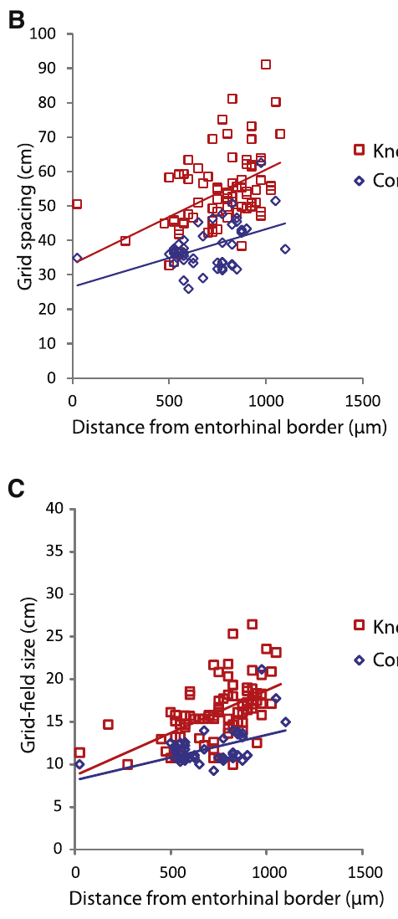
Spatial spacing is larger after HCN1 deletion
Grid spacing was greater in knockout mice than in controls across the sampled anatomical positions. Giocomo and colleagues plotted spacing against distance from the dorsal border of medial entorhinal cortex.
Comparing cells at similar anatomical levels reduced confusion between a genetic effect and the normal dorsal-to-ventral scale difference. The knockout relationship was shifted toward larger spacing while still increasing toward ventral positions.
The intervention establishes that HCN1 expression contributes to the normal range of spatial scale. It does not establish the exact synaptic calculation by which the channel changes spacing. The measured outcome is a change in the distance between activity fields, rather than disappearance of spatial coding.
Giocomo et al. (2011), Fig. 3(A, upper histology). Mouse sagittal brain section and entorhinal recording location.
Giocomo et al. (2011), Fig. 2(B,C). Grid spacing and field size versus depth.
Giocomo et al. (2011)
32
Notes:
• Grid spacing was greater in knockout mice than in controls across the sampled anatomical positions. Giocomo and colleagues plotted spacing against distance from the dorsal border of medial entorhinal cortex.
• Comparing cells at similar anatomical levels reduced confusion between a genetic effect and the normal dorsal-to-ventral scale difference. The knockout relationship was shifted toward larger spacing while still increasing toward ventral positions.
• The intervention establishes that HCN1 expression contributes to the normal range of spatial scale. It does not establish the exact synaptic calculation by which the channel changes spacing. The measured outcome is a change in the distance between activity fields, rather than disappearance of spatial coding.
References:
Giocomo LM, Hussaini SA, Zheng F, Kandel ER, Moser MB, Moser EI (2011). Grid cells use HCN1 channels for spatial scaling. Cell 147(5): 1159–1170. https://doi.org/10.1016/j.cell.2011.08.051
Figure: Giocomo et al. (2011), Fig. 2(B,C). Grid spacing and field size versus depth.
Figure source: https://doi.org/10.1016/j.cell.2011.08.051
Figure: Giocomo et al. (2011), Fig. 3(A, upper histology). Mouse sagittal brain section and entorhinal recording location.
Figure source: https://doi.org/10.1016/j.cell.2011.08.051

Slide 33
Field size and spacing expand proportionately
HCN1 knockout enlarged both grid spacing and the size of individual fields. These two measurements distinguished distance between repeated peaks from the extent of each elevated firing region.
The reported spacing-to-field-size ratios were approximately 3.26 in controls and 3.32 after knockout. Their similarity supports coordinated expansion of the pattern rather than selective broadening of fields without a corresponding spacing change.
A proportionately enlarged grid represents a coarser metric pattern. It does not directly imply poorer behavioral performance or reduced ability to identify a location. The experiment quantified neuronal spatial firing during exploration, and that measurement must be distinguished from a separate test of navigational accuracy or memory.
Giocomo et al. (2011), Fig. 3(A, upper histology). Mouse sagittal brain section and entorhinal recording location.
Giocomo et al. (2011), Fig. 2(B,C). Grid spacing and field size versus depth.
Giocomo et al. (2011)
33
Notes:
• HCN1 knockout enlarged both grid spacing and the size of individual fields. These two measurements distinguished distance between repeated peaks from the extent of each elevated firing region.
• The reported spacing-to-field-size ratios were approximately 3.26 in controls and 3.32 after knockout. Their similarity supports coordinated expansion of the pattern rather than selective broadening of fields without a corresponding spacing change.
• A proportionately enlarged grid represents a coarser metric pattern. It does not directly imply poorer behavioral performance or reduced ability to identify a location. The experiment quantified neuronal spatial firing during exploration, and that measurement must be distinguished from a separate test of navigational accuracy or memory.
References:
Giocomo LM, Hussaini SA, Zheng F, Kandel ER, Moser MB, Moser EI (2011). Grid cells use HCN1 channels for spatial scaling. Cell 147(5): 1159–1170. https://doi.org/10.1016/j.cell.2011.08.051
Figure: Giocomo et al. (2011), Fig. 2(B,C). Grid spacing and field size versus depth.
Figure source: https://doi.org/10.1016/j.cell.2011.08.051
Figure: Giocomo et al. (2011), Fig. 3(A, upper histology). Mouse sagittal brain section and entorhinal recording location.
Figure source: https://doi.org/10.1016/j.cell.2011.08.051

Slide 34
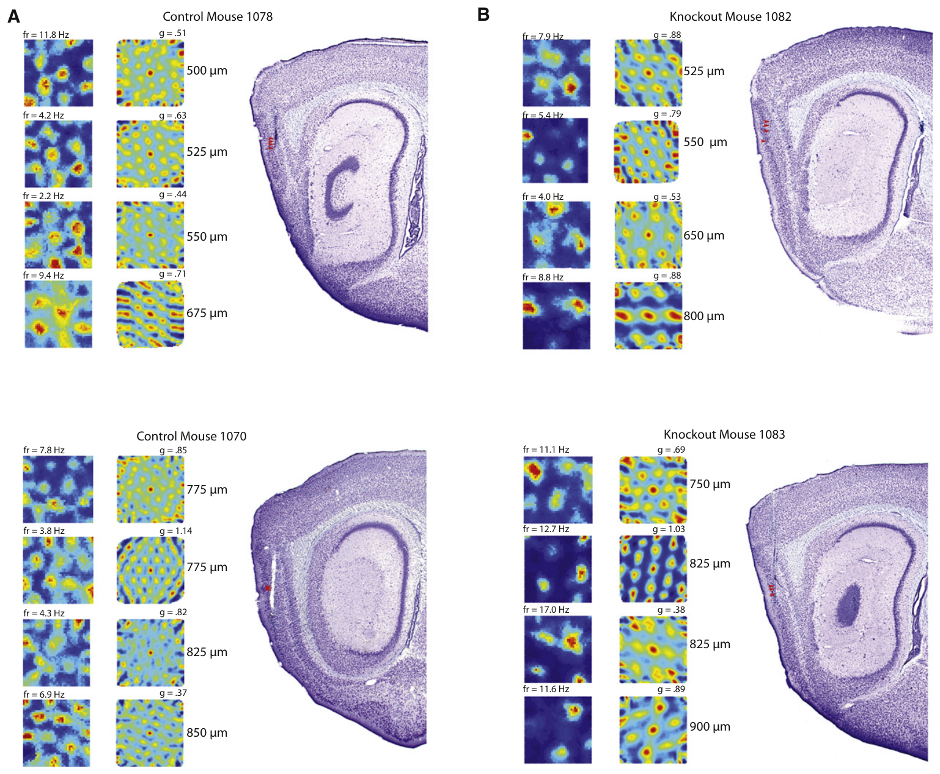
Histological matches strengthen the scale comparison
Giocomo and colleagues presented grid maps together with stained sections locating their recording sites. At similar distances from the dorsal entorhinal border, knockout examples had wider spacing than control examples.
The anatomical reconstruction used sagittal sections and cortical staining patterns to identify medial entorhinal cortex and its layers. Cytoarchitecture means the arrangement and appearance of cells used to distinguish tissue regions.
Matching anatomical locations makes a scale difference less likely to arise solely from recording deeper in the knockout group. Histology verifies where electrodes sampled activity, but does not prove identical cellular composition at every site or restrict a forebrain genetic manipulation to the neurons recorded there.
Giocomo et al. (2011), Fig. 3(A,B). Grid fields and corresponding stained sections.
Giocomo et al. (2011), Fig. 3(A, upper histology). Mouse sagittal brain section and entorhinal recording location.
Giocomo et al. (2011)
34
Notes:
• Giocomo and colleagues presented grid maps together with stained sections locating their recording sites. At similar distances from the dorsal entorhinal border, knockout examples had wider spacing than control examples.
• The anatomical reconstruction used sagittal sections and cortical staining patterns to identify medial entorhinal cortex and its layers. **Cytoarchitecture** means the arrangement and appearance of cells used to distinguish tissue regions.
• Matching anatomical locations makes a scale difference less likely to arise solely from recording deeper in the knockout group. Histology verifies where electrodes sampled activity, but does not prove identical cellular composition at every site or restrict a forebrain genetic manipulation to the neurons recorded there.
References:
Giocomo LM, Hussaini SA, Zheng F, Kandel ER, Moser MB, Moser EI (2011). Grid cells use HCN1 channels for spatial scaling. Cell 147(5): 1159–1170. https://doi.org/10.1016/j.cell.2011.08.051
Figure: Giocomo et al. (2011), Fig. 3(A,B). Grid fields and corresponding stained sections.
Figure source: https://doi.org/10.1016/j.cell.2011.08.051
Figure: Giocomo et al. (2011), Fig. 3(A, upper histology). Mouse sagittal brain section and entorhinal recording location.
Figure source: https://doi.org/10.1016/j.cell.2011.08.051

Slide 35
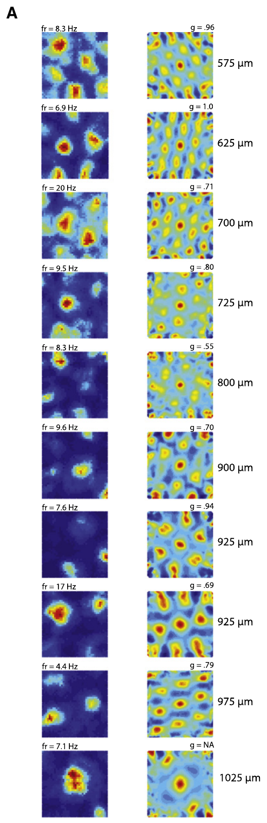
The dorsal-to-ventral scale gradient survives knockout
Within a single knockout animal, grid spacing still increased as recording locations progressed away from the dorsal border. Giocomo and colleagues used this within-animal series to test whether HCN1 deletion abolished the anatomical organization of scale.
The persistence of a gradient distinguished a general expansion of the scale range from loss of topographic organization. Topography is the systematic relationship between anatomical position and a measured functional property.
HCN1 therefore contributed to scale without providing the sole determinant of the dorsal-to-ventral relationship. Other cellular properties and circuit mechanisms remained possible contributors. The surviving gradient does not identify which of them is responsible, and it should not be attributed to a specific remaining current without additional measurements.
Giocomo et al. (2011), Fig. 3(A, upper histology). Mouse sagittal brain section and entorhinal recording location.
Giocomo et al. (2011), Fig. 4(A). Grid patterns along one knockout recording series.
Giocomo et al. (2011)
35
Notes:
• Within a single knockout animal, grid spacing still increased as recording locations progressed away from the dorsal border. Giocomo and colleagues used this within-animal series to test whether HCN1 deletion abolished the anatomical organization of scale.
• The persistence of a gradient distinguished a general expansion of the scale range from loss of topographic organization. **Topography** is the systematic relationship between anatomical position and a measured functional property.
• HCN1 therefore contributed to scale without providing the sole determinant of the dorsal-to-ventral relationship. Other cellular properties and circuit mechanisms remained possible contributors. The surviving gradient does not identify which of them is responsible, and it should not be attributed to a specific remaining current without additional measurements.
References:
Giocomo LM, Hussaini SA, Zheng F, Kandel ER, Moser MB, Moser EI (2011). Grid cells use HCN1 channels for spatial scaling. Cell 147(5): 1159–1170. https://doi.org/10.1016/j.cell.2011.08.051
Figure: Giocomo et al. (2011), Fig. 4(A). Grid patterns along one knockout recording series.
Figure source: https://doi.org/10.1016/j.cell.2011.08.051
Figure: Giocomo et al. (2011), Fig. 3(A, upper histology). Mouse sagittal brain section and entorhinal recording location.
Figure source: https://doi.org/10.1016/j.cell.2011.08.051

Slide 36
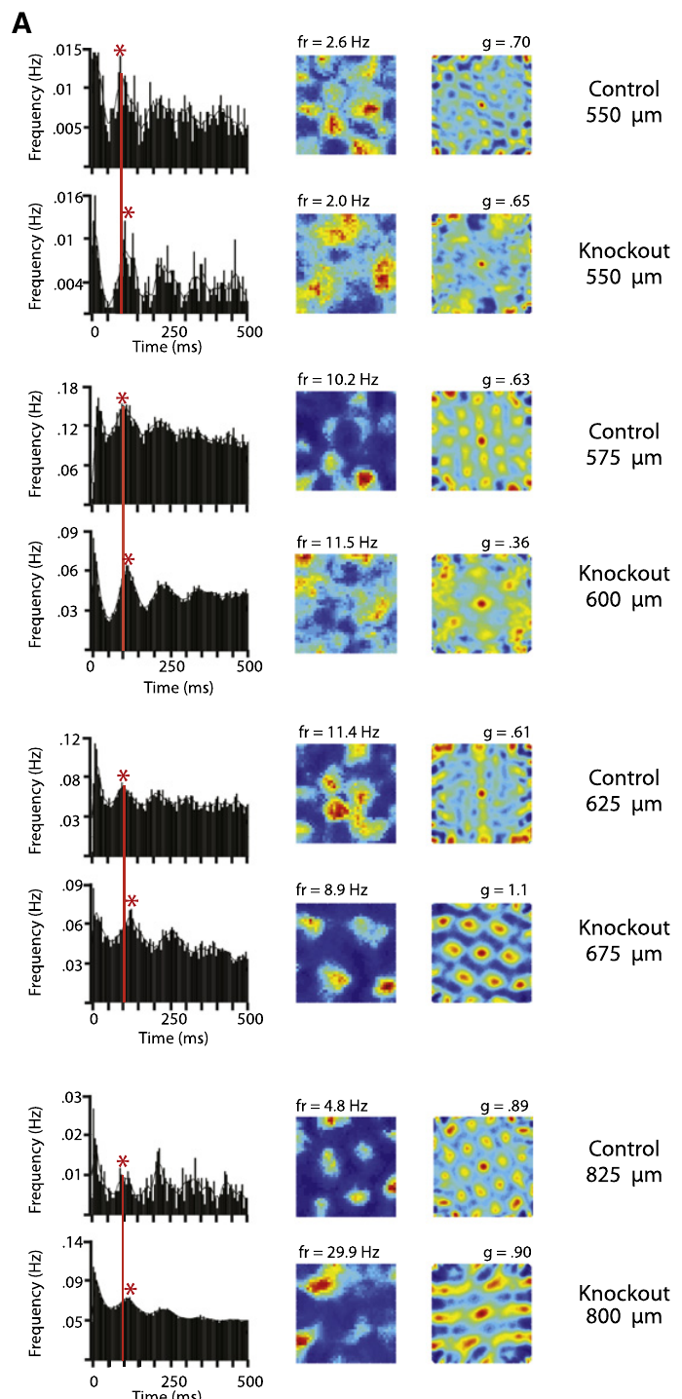
Slower theta timing accompanies larger grid spacing
Theta modulation is a recurring change in neuronal firing associated with a low-frequency rhythm. Giocomo and colleagues compared spike-time autocorrelations of grid cells in control and knockout mice.
The typical interval between theta-related peaks was longer after knockout: the reported values were 108.1 ms in controls and 114.4 ms in knockout grid cells. The enlarged spatial pattern therefore accompanied a slower recurring timescale of firing.
A temporal autocorrelation measures how often spikes recur at different time lags. It does not measure the physical spacing of fields. The association between slower timing and wider spacing constrains proposed mechanisms, but correlation of the two outcomes does not by itself establish which one causes the other.
Giocomo et al. (2011), Fig. 3(A, upper histology). Mouse sagittal brain section and entorhinal recording location.
Giocomo et al. (2011), Fig. 5(A). Spike-time and spatial autocorrelations.
Giocomo et al. (2011)
36
Notes:
• **Theta modulation** is a recurring change in neuronal firing associated with a low-frequency rhythm. Giocomo and colleagues compared spike-time autocorrelations of grid cells in control and knockout mice.
• The typical interval between theta-related peaks was longer after knockout: the reported values were 108.1 ms in controls and 114.4 ms in knockout grid cells. The enlarged spatial pattern therefore accompanied a slower recurring timescale of firing.
• A **temporal autocorrelation** measures how often spikes recur at different time lags. It does not measure the physical spacing of fields. The association between slower timing and wider spacing constrains proposed mechanisms, but correlation of the two outcomes does not by itself establish which one causes the other.
References:
Giocomo LM, Hussaini SA, Zheng F, Kandel ER, Moser MB, Moser EI (2011). Grid cells use HCN1 channels for spatial scaling. Cell 147(5): 1159–1170. https://doi.org/10.1016/j.cell.2011.08.051
Figure: Giocomo et al. (2011), Fig. 5(A). Spike-time and spatial autocorrelations.
Figure source: https://doi.org/10.1016/j.cell.2011.08.051
Figure: Giocomo et al. (2011), Fig. 3(A, upper histology). Mouse sagittal brain section and entorhinal recording location.
Figure source: https://doi.org/10.1016/j.cell.2011.08.051

Slide 37
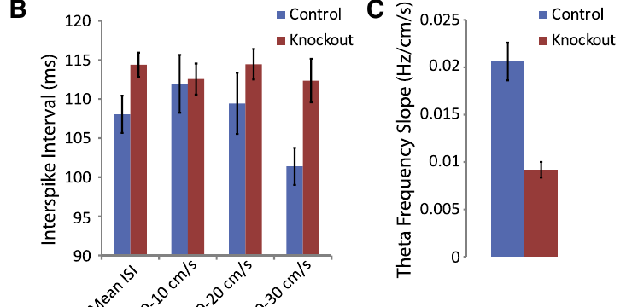
Running speed changes the timing comparison
Movement speed can influence theta-related activity, so Giocomo and colleagues compared groups across speed ranges. At 20–30 cm/s, the reported theta-related spike intervals were 101.4 ms in controls and 112.4 ms after HCN1 knockout.
The difference remained at comparable speeds, reducing an explanation based entirely on the knockout animals' faster average movement. The speed comparison separated a behavioral covariate from the genetic change in neuronal timing.
The result is consistent with altered coupling between movement and the spatial code. It does not establish that the channel directly detects speed. HCN1 influences neuronal integration, while the origin and routing of velocity-related inputs require separate circuit measurements.
Giocomo et al. (2011), Fig. 5(B,C). Theta timing and speed modulation.
Giocomo et al. (2011), Fig. 3(A, upper histology). Mouse sagittal brain section and entorhinal recording location.
Giocomo et al. (2011)
37
Notes:
• Movement speed can influence theta-related activity, so Giocomo and colleagues compared groups across speed ranges. At 20–30 cm/s, the reported theta-related spike intervals were 101.4 ms in controls and 112.4 ms after HCN1 knockout.
• The difference remained at comparable speeds, reducing an explanation based entirely on the knockout animals' faster average movement. The speed comparison separated a behavioral covariate from the genetic change in neuronal timing.
• The result is consistent with altered coupling between movement and the spatial code. It does not establish that the channel directly detects speed. HCN1 influences neuronal integration, while the origin and routing of velocity-related inputs require separate circuit measurements.
References:
Giocomo LM, Hussaini SA, Zheng F, Kandel ER, Moser MB, Moser EI (2011). Grid cells use HCN1 channels for spatial scaling. Cell 147(5): 1159–1170. https://doi.org/10.1016/j.cell.2011.08.051
Figure: Giocomo et al. (2011), Fig. 5(B,C). Theta timing and speed modulation.
Figure source: https://doi.org/10.1016/j.cell.2011.08.051
Figure: Giocomo et al. (2011), Fig. 3(A, upper histology). Mouse sagittal brain section and entorhinal recording location.
Figure source: https://doi.org/10.1016/j.cell.2011.08.051

Slide 38
Local-field theta and single-cell timing are distinct
A local field potential is the extracellular voltage produced by coordinated activity in nearby tissue. Its theta frequency differs from the frequency inferred from repeated spikes of one neuron.
Giocomo and colleagues reported average entorhinal field-theta frequencies of 8.63 Hz in controls and 8.25 Hz after knockout. The increase of field-theta frequency with running speed was also weaker in knockout mice.
These observations connect the channel intervention to population-level timing as well as grid-cell scale. They do not establish that every recorded grid cell fires exactly once per field-theta cycle. Individual discharge timing and the surrounding field rhythm must be measured separately before a proposed phase relationship can be evaluated.
Giocomo et al. (2011), Fig. 5(B,C). Theta timing and speed modulation.
Giocomo et al. (2011), Fig. 3(A, upper histology). Mouse sagittal brain section and entorhinal recording location.
Giocomo et al. (2011)
38
Notes:
• A **local field potential** is the extracellular voltage produced by coordinated activity in nearby tissue. Its theta frequency differs from the frequency inferred from repeated spikes of one neuron.
• Giocomo and colleagues reported average entorhinal field-theta frequencies of 8.63 Hz in controls and 8.25 Hz after knockout. The increase of field-theta frequency with running speed was also weaker in knockout mice.
• These observations connect the channel intervention to population-level timing as well as grid-cell scale. They do not establish that every recorded grid cell fires exactly once per field-theta cycle. Individual discharge timing and the surrounding field rhythm must be measured separately before a proposed phase relationship can be evaluated.
References:
Giocomo LM, Hussaini SA, Zheng F, Kandel ER, Moser MB, Moser EI (2011). Grid cells use HCN1 channels for spatial scaling. Cell 147(5): 1159–1170. https://doi.org/10.1016/j.cell.2011.08.051
Figure: Giocomo et al. (2011), Fig. 5(B,C). Theta timing and speed modulation.
Figure source: https://doi.org/10.1016/j.cell.2011.08.051
Figure: Giocomo et al. (2011), Fig. 3(A, upper histology). Mouse sagittal brain section and entorhinal recording location.
Figure source: https://doi.org/10.1016/j.cell.2011.08.051

Slide 39
Interneuron timing provides a cell-class comparison
An interneuron is a neuron whose principal connections remain within a local circuit. Giocomo and colleagues compared theta-modulated entorhinal interneurons with the principal cells carrying the grid-cell spatial pattern.
The knockout-related increase in theta timing was present in grid cells but was not comparably detected in the simultaneously recorded interneuron population. This comparison argues against a uniform slowing of every recorded neuron.
Cell-class differences constrain how a molecular intervention affects network dynamics. The study did not directly measure transmitter release or receptor currents from the recorded interneurons. Their comparison supports a selective physiological effect without specifying every inhibitory synapse or proving that all inhibitory circuitry remained unchanged.
Giocomo et al. (2011), Fig. 3(A, upper histology). Mouse sagittal brain section and entorhinal recording location.
Giocomo et al. (2011), Fig. 5(A). Spike-time and spatial autocorrelations.
Giocomo et al. (2011)
39
Notes:
• An **interneuron** is a neuron whose principal connections remain within a local circuit. Giocomo and colleagues compared theta-modulated entorhinal interneurons with the principal cells carrying the grid-cell spatial pattern.
• The knockout-related increase in theta timing was present in grid cells but was not comparably detected in the simultaneously recorded interneuron population. This comparison argues against a uniform slowing of every recorded neuron.
• Cell-class differences constrain how a molecular intervention affects network dynamics. The study did not directly measure transmitter release or receptor currents from the recorded interneurons. Their comparison supports a selective physiological effect without specifying every inhibitory synapse or proving that all inhibitory circuitry remained unchanged.
References:
Giocomo LM, Hussaini SA, Zheng F, Kandel ER, Moser MB, Moser EI (2011). Grid cells use HCN1 channels for spatial scaling. Cell 147(5): 1159–1170. https://doi.org/10.1016/j.cell.2011.08.051
Figure: Giocomo et al. (2011), Fig. 5(A). Spike-time and spatial autocorrelations.
Figure source: https://doi.org/10.1016/j.cell.2011.08.051
Figure: Giocomo et al. (2011), Fig. 3(A, upper histology). Mouse sagittal brain section and entorhinal recording location.
Figure source: https://doi.org/10.1016/j.cell.2011.08.051

Slide 40
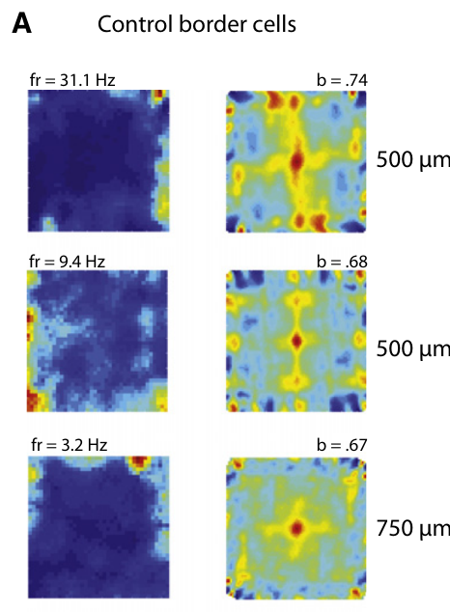
Border cells provide a separate boundary-related code
A border cell fires most strongly near one or more environmental boundaries. Giocomo and colleagues recorded boundary-related activity in the same entorhinal region used to study grid cells.
The maps concentrated activity along walls rather than at the repeated interior locations characteristic of a grid. Border-related firing remained identifiable after HCN1 deletion, providing a comparison with the enlarged grid pattern.
A boundary code supplies information different from grid spacing: it relates activity to environmental edges. Its persistence indicates that knockout did not eliminate every form of spatial tuning. The comparison does not establish how border-cell input interacts synaptically with the grid network or whether each class is independently sufficient for navigation.
Giocomo et al. (2011), Fig. 3(A, upper histology). Mouse sagittal brain section and entorhinal recording location.
Giocomo et al. (2011), Fig. 6(A). Boundary-related firing in control mice.
Giocomo et al. (2011)
40
Notes:
• A **border cell** fires most strongly near one or more environmental boundaries. Giocomo and colleagues recorded boundary-related activity in the same entorhinal region used to study grid cells.
• The maps concentrated activity along walls rather than at the repeated interior locations characteristic of a grid. Border-related firing remained identifiable after HCN1 deletion, providing a comparison with the enlarged grid pattern.
• A boundary code supplies information different from grid spacing: it relates activity to environmental edges. Its persistence indicates that knockout did not eliminate every form of spatial tuning. The comparison does not establish how border-cell input interacts synaptically with the grid network or whether each class is independently sufficient for navigation.
References:
Giocomo LM, Hussaini SA, Zheng F, Kandel ER, Moser MB, Moser EI (2011). Grid cells use HCN1 channels for spatial scaling. Cell 147(5): 1159–1170. https://doi.org/10.1016/j.cell.2011.08.051
Figure: Giocomo et al. (2011), Fig. 6(A). Boundary-related firing in control mice.
Figure source: https://doi.org/10.1016/j.cell.2011.08.051
Figure: Giocomo et al. (2011), Fig. 3(A, upper histology). Mouse sagittal brain section and entorhinal recording location.
Figure source: https://doi.org/10.1016/j.cell.2011.08.051

Slide 41
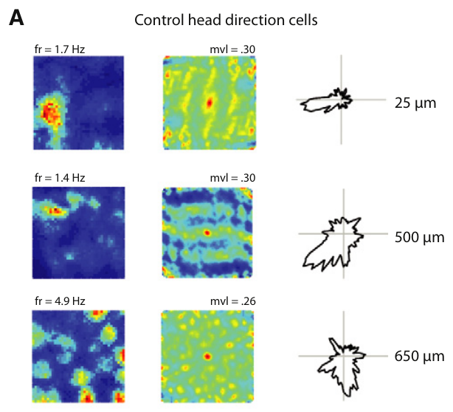
Head-direction cells represent where the animal faces
A head-direction cell fires preferentially when the animal's head points toward a particular direction. Giocomo and colleagues used two tracking lights to estimate heading and compared firing across angles.
Directional tuning remained present in control and knockout mice. A directional response is distinct from a grid field: an animal can face the preferred direction at several locations, whereas a grid cell's rate is organized by repeated spatial positions.
This comparison separates directional coding from the genetic effect on grid scale. The continued directional signal does not prove that it reaches every grid cell normally. Establishing the transformation from heading and speed into location requires measurements of the relevant inputs and their circuit interactions.
Giocomo et al. (2011), Fig. 7(A). Directional firing in control mice.
Giocomo et al. (2011), Fig. 3(A, upper histology). Mouse sagittal brain section and entorhinal recording location.
Giocomo et al. (2011)
41
Notes:
• A **head-direction cell** fires preferentially when the animal's head points toward a particular direction. Giocomo and colleagues used two tracking lights to estimate heading and compared firing across angles.
• Directional tuning remained present in control and knockout mice. A directional response is distinct from a grid field: an animal can face the preferred direction at several locations, whereas a grid cell's rate is organized by repeated spatial positions.
• This comparison separates directional coding from the genetic effect on grid scale. The continued directional signal does not prove that it reaches every grid cell normally. Establishing the transformation from heading and speed into location requires measurements of the relevant inputs and their circuit interactions.
References:
Giocomo LM, Hussaini SA, Zheng F, Kandel ER, Moser MB, Moser EI (2011). Grid cells use HCN1 channels for spatial scaling. Cell 147(5): 1159–1170. https://doi.org/10.1016/j.cell.2011.08.051
Figure: Giocomo et al. (2011), Fig. 7(A). Directional firing in control mice.
Figure source: https://doi.org/10.1016/j.cell.2011.08.051
Figure: Giocomo et al. (2011), Fig. 3(A, upper histology). Mouse sagittal brain section and entorhinal recording location.
Figure source: https://doi.org/10.1016/j.cell.2011.08.051

Slide 42
HCN1 deletion increases within-trial spatial stability
Spatial stability describes the consistency of a neuron's firing pattern across repeated portions of a recording. Giocomo and colleagues compared maps from the first and second halves of each trial.
Grid and border patterns were more stable in knockout mice, while directional stability did not change comparably. The analysis also considered grid spacing because broader patterns can appear more stable than narrower patterns under the same displacement.
Greater consistency of activity is distinct from greater spatial precision. A broader field can remain stable while distinguishing positions less sharply. The observed stability difference therefore should not be equated directly with improved navigation or treated as proof of a specific synaptic plasticity mechanism.
Giocomo et al. (2011), Fig. 3(A, upper histology). Mouse sagittal brain section and entorhinal recording location.
Giocomo et al. (2011), Fig. 2(A). Grid patterns at several recording depths.
Giocomo et al. (2011)
42
Notes:
• **Spatial stability** describes the consistency of a neuron's firing pattern across repeated portions of a recording. Giocomo and colleagues compared maps from the first and second halves of each trial.
• Grid and border patterns were more stable in knockout mice, while directional stability did not change comparably. The analysis also considered grid spacing because broader patterns can appear more stable than narrower patterns under the same displacement.
• Greater consistency of activity is distinct from greater spatial precision. A broader field can remain stable while distinguishing positions less sharply. The observed stability difference therefore should not be equated directly with improved navigation or treated as proof of a specific synaptic plasticity mechanism.
References:
Giocomo LM, Hussaini SA, Zheng F, Kandel ER, Moser MB, Moser EI (2011). Grid cells use HCN1 channels for spatial scaling. Cell 147(5): 1159–1170. https://doi.org/10.1016/j.cell.2011.08.051
Figure: Giocomo et al. (2011), Fig. 2(A). Grid patterns at several recording depths.
Figure source: https://doi.org/10.1016/j.cell.2011.08.051
Figure: Giocomo et al. (2011), Fig. 3(A, upper histology). Mouse sagittal brain section and entorhinal recording location.
Figure source: https://doi.org/10.1016/j.cell.2011.08.051

Slide 43
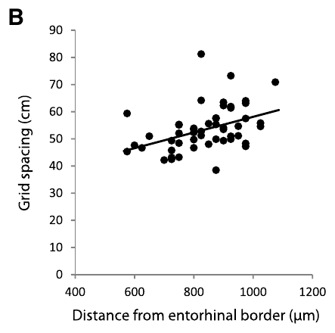
The knockout constrains oscillatory explanations of grids
An oscillatory interference model proposes that relationships between oscillations contribute to spatially periodic firing. Giocomo and colleagues examined their knockout results in relation to proposed links between intrinsic timing and grid scale.
HCN1 deletion enlarged spacing but preserved the dorsal-to-ventral gradient. The authors contrasted that result with earlier cellular observations that HCN1 deletion strongly alters the anatomical gradient of resonance.
The mismatch challenges explanations in which the HCN1-dependent resonance gradient alone determines the scale gradient. It does not disprove every oscillatory mechanism. Different versions make different predictions, and the forebrain intervention also leaves other intrinsic currents and network interactions available to influence activity.
Giocomo et al. (2011), Fig. 4(B). Spacing versus depth within a knockout animal.
Giocomo et al. (2011), Fig. 3(A, upper histology). Mouse sagittal brain section and entorhinal recording location.
Giocomo et al. (2011)
43
Notes:
• An **oscillatory interference model** proposes that relationships between oscillations contribute to spatially periodic firing. Giocomo and colleagues examined their knockout results in relation to proposed links between intrinsic timing and grid scale.
• HCN1 deletion enlarged spacing but preserved the dorsal-to-ventral gradient. The authors contrasted that result with earlier cellular observations that HCN1 deletion strongly alters the anatomical gradient of resonance.
• The mismatch challenges explanations in which the HCN1-dependent resonance gradient alone determines the scale gradient. It does not disprove every oscillatory mechanism. Different versions make different predictions, and the forebrain intervention also leaves other intrinsic currents and network interactions available to influence activity.
References:
Giocomo LM, Hussaini SA, Zheng F, Kandel ER, Moser MB, Moser EI (2011). Grid cells use HCN1 channels for spatial scaling. Cell 147(5): 1159–1170. https://doi.org/10.1016/j.cell.2011.08.051
Figure: Giocomo et al. (2011), Fig. 4(B). Spacing versus depth within a knockout animal.
Figure source: https://doi.org/10.1016/j.cell.2011.08.051
Figure: Giocomo et al. (2011), Fig. 3(A, upper histology). Mouse sagittal brain section and entorhinal recording location.
Figure source: https://doi.org/10.1016/j.cell.2011.08.051

Slide 44
Spatial coding does not establish navigational causation
The three studies establish different levels of evidence: spatially dependent hippocampal responses, periodic entorhinal firing, and a genetic contribution to the spatial scale of that periodic activity. Their experimental outcomes should be kept distinct.
HCN1 knockout provides a perturbation of a candidate cellular mechanism, whereas grid recordings in darkness and under landmark rotation compare conditions affecting an intact spatial code. Each manipulation limits a different explanation of the measured firing.
None of these recordings alone identifies a complete route-planning algorithm. A causal account of navigation additionally requires linking the altered representation to behavior under a defined spatial demand, with controls for movement, sensory information, and the broader effects of the intervention.
Giocomo et al. (2011), Fig. 3(A,B). Grid fields and corresponding stained sections.
Giocomo et al. (2011), Fig. 3(A, upper histology). Mouse sagittal brain section and entorhinal recording location.
Giocomo et al. (2011)
44
Notes:
• The three studies establish different levels of evidence: spatially dependent hippocampal responses, periodic entorhinal firing, and a genetic contribution to the spatial scale of that periodic activity. Their experimental outcomes should be kept distinct.
• HCN1 knockout provides a perturbation of a candidate cellular mechanism, whereas grid recordings in darkness and under landmark rotation compare conditions affecting an intact spatial code. Each manipulation limits a different explanation of the measured firing.
• None of these recordings alone identifies a complete route-planning algorithm. A causal account of navigation additionally requires linking the altered representation to behavior under a defined spatial demand, with controls for movement, sensory information, and the broader effects of the intervention.
References:
Giocomo LM, Hussaini SA, Zheng F, Kandel ER, Moser MB, Moser EI (2011). Grid cells use HCN1 channels for spatial scaling. Cell 147(5): 1159–1170. https://doi.org/10.1016/j.cell.2011.08.051
Figure: Giocomo et al. (2011), Fig. 3(A,B). Grid fields and corresponding stained sections.
Figure source: https://doi.org/10.1016/j.cell.2011.08.051
Figure: Giocomo et al. (2011), Fig. 3(A, upper histology). Mouse sagittal brain section and entorhinal recording location.
Figure source: https://doi.org/10.1016/j.cell.2011.08.051

Slide 45
Movement-to-space gain is a hypothesis about integration
Gain describes how strongly a system's output changes in response to its input. Giocomo and colleagues proposed that HCN1-dependent integration contributes to the gain linking movement signals with changes in the spatial firing pattern.
After HCN1 deletion, wider field spacing accompanied weaker modulation of theta frequency by running speed. These outcomes were compatible with an altered movement-to-space relationship, while the preserved anatomical scale gradient required additional determinants.
The study did not directly record every velocity input or measure its transfer through identified synapses. Gain regulation is therefore a proposed explanation connecting the molecular intervention to spatial activity, rather than a measured circuit diagram or a complete account of how a grid is generated.
Giocomo et al. (2011), Fig. 3(A, upper histology). Mouse sagittal brain section and entorhinal recording location.
Giocomo et al. (2011), Fig. 2(B,C). Grid spacing and field size versus depth.
Giocomo et al. (2011)
45
Notes:
• **Gain** describes how strongly a system's output changes in response to its input. Giocomo and colleagues proposed that HCN1-dependent integration contributes to the gain linking movement signals with changes in the spatial firing pattern.
• After HCN1 deletion, wider field spacing accompanied weaker modulation of theta frequency by running speed. These outcomes were compatible with an altered movement-to-space relationship, while the preserved anatomical scale gradient required additional determinants.
• The study did not directly record every velocity input or measure its transfer through identified synapses. Gain regulation is therefore a proposed explanation connecting the molecular intervention to spatial activity, rather than a measured circuit diagram or a complete account of how a grid is generated.
References:
Giocomo LM, Hussaini SA, Zheng F, Kandel ER, Moser MB, Moser EI (2011). Grid cells use HCN1 channels for spatial scaling. Cell 147(5): 1159–1170. https://doi.org/10.1016/j.cell.2011.08.051
Figure: Giocomo et al. (2011), Fig. 2(B,C). Grid spacing and field size versus depth.
Figure source: https://doi.org/10.1016/j.cell.2011.08.051
Figure: Giocomo et al. (2011), Fig. 3(A, upper histology). Mouse sagittal brain section and entorhinal recording location.
Figure source: https://doi.org/10.1016/j.cell.2011.08.051

Slide 46
Key takeaways
Place coding. Hippocampal activity can depend on location together with sensory conditions, facing direction and behavioral state.
Grid geometry. Entorhinal grid cells have repeated fields whose spacing, orientation and spatial phase are distinct properties.
Landmarks and self-motion. Landmarks align grid activity; persistence in darkness supports movement-based updating without proving independence from all external cues.
Anatomical scale. Grid spacing and field size increase toward ventral entorhinal recording locations.
HCN1 contribution. Forebrain HCN1 deletion expands grid scale and slows theta-related timing while preserving periodicity and the anatomical scale gradient.
Evidence and mechanism. Spatial firing establishes a representation; a complete causal account of navigation requires circuit and behavioral tests beyond these recordings.
O'Keefe & Dostrovsky (1971); Hafting et al. (2005); Giocomo et al. (2011)
46
Notes:
O'Keefe J, Dostrovsky J (1971). The hippocampus as a spatial map. Preliminary evidence from unit activity in the freely-moving rat. Brain Research 34(1): 171–175. https://doi.org/10.1016/0006-8993(71)90358-1
Hafting T, Fyhn M, Molden S, Moser MB, Moser EI (2005). Microstructure of a spatial map in the entorhinal cortex. Nature 436(7052): 801–806. https://doi.org/10.1038/nature03721
Giocomo LM, Hussaini SA, Zheng F, Kandel ER, Moser MB, Moser EI (2011). Grid cells use HCN1 channels for spatial scaling. Cell 147(5): 1159–1170. https://doi.org/10.1016/j.cell.2011.08.051

