Slide 1
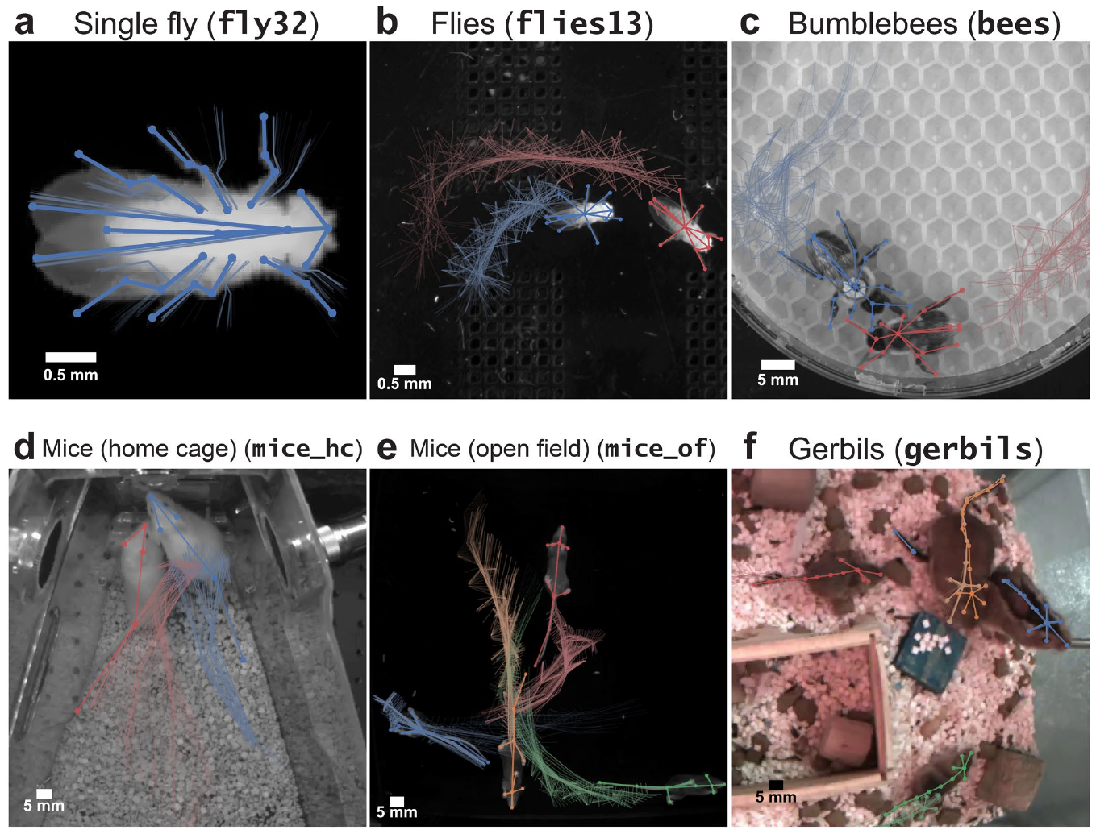
NEUR 411 · NEUROETHOLOGY · FALL 2026
Lecture 86
Computational Methods in Animal Research I:
Welfare across species, Computer vision meets animal vision, tracking, virtual prey, and Designing games for animal minds, perception, agency, motivation
Date TBD
Pereira et al. (2022), Extended Data Fig. 1(a–f). Study animals and species-specific body landmarks.
Jordan Lopez, Ph.D.
Professor of Neurobiology & Biomedical Engineering
Notes:
Computational Methods in Animal Research I: Welfare across species, Computer vision meets animal vision, tracking, virtual prey, and Designing games for animal minds, perception, agency, motivation
Lecture 86. NEUR 411 · NEUROETHOLOGY · FALL 2026. Date TBD.
Figure: Pereira et al. (2022), Extended Data Fig. 1(a–f). Study animals and species-specific body landmarks.
Figure source: https://doi.org/10.1038/s41592-022-01426-1
References:
Pereira TD, Tabris N, Matsliah A, Turner DM, Li J, Ravindranath S, Papadoyannis ES, Normand E, Deutsch DS, Wang ZY, McKenzie-Smith GC, Mitelut CC, Castro MD, D’Uva J, Kislin M, Sanes DH, Kocher SD, Wang SSH, Falkner AL, Shaevitz JW, Murthy M (2022). SLEAP: A deep learning system for multi-animal pose tracking. Nature Methods 19:486-495. https://doi.org/10.1038/s41592-022-01426-1

Slide 2
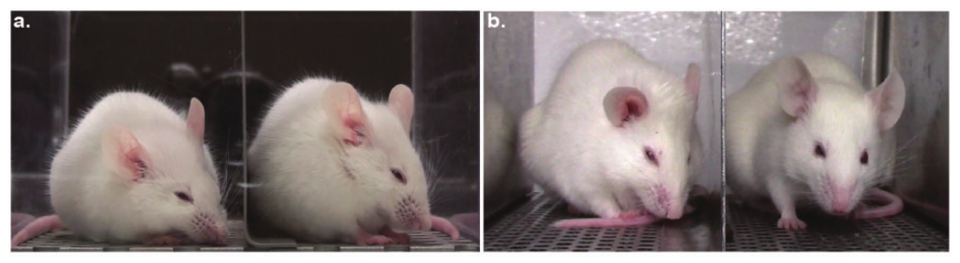
Facial changes provide a measurable pain indicator
Spontaneous pain is pain expressed without an experimenter applying a test stimulus. Tuttle and colleagues measured it through changes in mouse facial appearance after inflammatory injury or surgery. A face-based measure samples ongoing behavior rather than the withdrawal response to a newly applied stimulus.
The Mouse Grimace Scale scores orbital tightening, nose bulge, cheek bulge, ear position and whisker changes. Each facial action unit receives a score for an absent, moderate or marked change. These defined features make the classification depend on specified facial configurations rather than a general impression that a mouse looks uncomfortable.
Blinded human scoring supplied the labels for an automated classifier. The computer learned associations between recorded faces and those labels; subsequent testing used new images and experimental conditions. Welfare measurement therefore connected a visible phenotype to a validated injury-and-treatment comparison.
Tuttle et al. (2018), Fig. 1(a–b). Mouse faces and recording arrangements.
Tuttle et al. (2018)
02
Notes:
• Spontaneous pain is pain expressed without an experimenter applying a test stimulus. Tuttle and colleagues measured it through changes in mouse facial appearance after inflammatory injury or surgery. A face-based measure samples ongoing behavior rather than the withdrawal response to a newly applied stimulus.
• The Mouse Grimace Scale scores orbital tightening, nose bulge, cheek bulge, ear position and whisker changes. Each facial action unit receives a score for an absent, moderate or marked change. These defined features make the classification depend on specified facial configurations rather than a general impression that a mouse looks uncomfortable.
• Blinded human scoring supplied the labels for an automated classifier. The computer learned associations between recorded faces and those labels; subsequent testing used new images and experimental conditions. Welfare measurement therefore connected a visible phenotype to a validated injury-and-treatment comparison.
References:
Tuttle AH, Molinaro MJ, Jethwa JF, Sotocinal SG, Prieto JC, Styner MA, Mogil JS, Zylka MJ (2018). A deep neural network to assess spontaneous pain from mouse facial expressions. Molecular Pain 14:1744806918763658. https://doi.org/10.1177/1744806918763658
Figure: Tuttle et al. (2018), Fig. 1(a–b). Mouse faces and recording arrangements.
Figure source: https://doi.org/10.1177/1744806918763658

Slide 3
The recording environment changes the available faces
Clear views of the eyes and ears are necessary for scoring grimacing. In the traditional arrangement, transparent walls allowed cameras to view a mouse from two directions, but reflections could obscure facial detail. Animals also changed their orientation, so many recorded frames lacked an adequately visible face.
Tuttle and colleagues used an open-front elevated arrangement that encouraged mice to face the camera. Recording through air reduced reflections, and one camera could capture usable faces more consistently. The change in recording geometry also changed the animal’s immediate surroundings, including its exposure to an edge.
Face extraction selected usable images rather than counting every frame as an independent observation. Frames were sampled at intervals, and blurred or obscured faces were excluded. The resulting measurement depended on both the mouse’s expression and the conditions under which its face became visible.
Tuttle et al. (2018), Fig. 1(a–b). Enclosed and open-front recording conditions.
Tuttle et al. (2018)
03
Notes:
• Clear views of the eyes and ears are necessary for scoring grimacing. In the traditional arrangement, transparent walls allowed cameras to view a mouse from two directions, but reflections could obscure facial detail. Animals also changed their orientation, so many recorded frames lacked an adequately visible face.
• Tuttle and colleagues used an open-front elevated arrangement that encouraged mice to face the camera. Recording through air reduced reflections, and one camera could capture usable faces more consistently. The change in recording geometry also changed the animal’s immediate surroundings, including its exposure to an edge.
• Face extraction selected usable images rather than counting every frame as an independent observation. Frames were sampled at intervals, and blurred or obscured faces were excluded. The resulting measurement depended on both the mouse’s expression and the conditions under which its face became visible.
References:
Tuttle AH, Molinaro MJ, Jethwa JF, Sotocinal SG, Prieto JC, Styner MA, Mogil JS, Zylka MJ (2018). A deep neural network to assess spontaneous pain from mouse facial expressions. Molecular Pain 14:1744806918763658. https://doi.org/10.1177/1744806918763658
Figure: Tuttle et al. (2018), Fig. 1(a–b). Enclosed and open-front recording conditions.
Figure source: https://doi.org/10.1177/1744806918763658

Slide 4
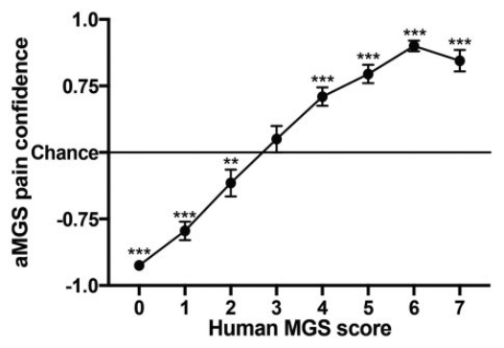
Transfer learning reuses visual features for scoring
Transfer learning adapts a model previously trained on another image task. Tuttle and colleagues used InceptionV3, a convolutional neural network, and retrained its final classification layers with mouse facial images. A convolutional network extracts spatial patterns from neighboring pixels and combines them into progressively more complex features.
The training images carried human-assigned pain or no-pain labels. Separate held-out images tested whether the classifier recognized new faces rather than merely reproducing its training labels. The output included a category and a confidence score, the model’s strength of preference for its selected category.
Classification accuracy increased when analysis retained only high-confidence predictions. That filtering also removed uncertain images from the evaluated set. A stricter threshold therefore trades coverage of the recording for more reliable classification among the retained faces, rather than improving every ambiguous frame.
Tuttle et al. (2018), Fig. 2. Human and automated grimace classification.
Tuttle et al. (2018)
04
Notes:
• Transfer learning adapts a model previously trained on another image task. Tuttle and colleagues used InceptionV3, a convolutional neural network, and retrained its final classification layers with mouse facial images. A convolutional network extracts spatial patterns from neighboring pixels and combines them into progressively more complex features.
• The training images carried human-assigned pain or no-pain labels. Separate held-out images tested whether the classifier recognized new faces rather than merely reproducing its training labels. The output included a category and a confidence score, the model’s strength of preference for its selected category.
• Classification accuracy increased when analysis retained only high-confidence predictions. That filtering also removed uncertain images from the evaluated set. A stricter threshold therefore trades coverage of the recording for more reliable classification among the retained faces, rather than improving every ambiguous frame.
References:
Tuttle AH, Molinaro MJ, Jethwa JF, Sotocinal SG, Prieto JC, Styner MA, Mogil JS, Zylka MJ (2018). A deep neural network to assess spontaneous pain from mouse facial expressions. Molecular Pain 14:1744806918763658. https://doi.org/10.1177/1744806918763658
Figure: Tuttle et al. (2018), Fig. 2. Human and automated grimace classification.
Figure source: https://doi.org/10.1177/1744806918763658

Slide 5
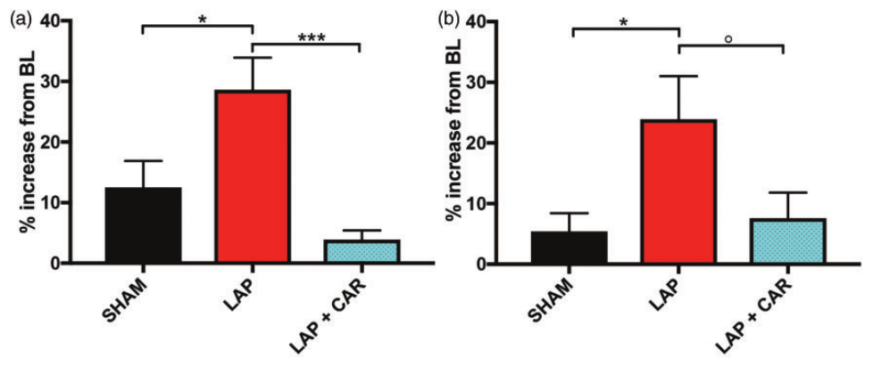
Analgesic responses validate a behavioral indicator
A laparotomy, an incision into the abdominal cavity, produced postoperative facial changes that the automated method classified as pain. Sham-treated animals underwent comparison procedures without the same surgical injury. Recording before and after the intervention tied changes in facial behavior to an experimentally defined event.
Carprofen is a nonsteroidal anti-inflammatory analgesic. In the study, treatment reduced postoperative grimacing by the later observation period, approximately 60 minutes after surgery. The treatment comparison linked the facial signal to a response expected when pain is relieved, rather than only to a difference between preoperative and postoperative images.
Sham procedures and anesthesia also affected early facial classifications. The timing of measurement consequently altered the interpretation of the same visual features. Behavioral monitoring can distinguish injury-related change more effectively when baseline recordings, procedure controls and treatment responses are evaluated together.
Tuttle et al. (2018), Fig. 3. Postoperative grimacing and carprofen treatment.
Tuttle et al. (2018)
05
Notes:
• A laparotomy, an incision into the abdominal cavity, produced postoperative facial changes that the automated method classified as pain. Sham-treated animals underwent comparison procedures without the same surgical injury. Recording before and after the intervention tied changes in facial behavior to an experimentally defined event.
• Carprofen is a nonsteroidal anti-inflammatory analgesic. In the study, treatment reduced postoperative grimacing by the later observation period, approximately 60 minutes after surgery. The treatment comparison linked the facial signal to a response expected when pain is relieved, rather than only to a difference between preoperative and postoperative images.
• Sham procedures and anesthesia also affected early facial classifications. The timing of measurement consequently altered the interpretation of the same visual features. Behavioral monitoring can distinguish injury-related change more effectively when baseline recordings, procedure controls and treatment responses are evaluated together.
References:
Tuttle AH, Molinaro MJ, Jethwa JF, Sotocinal SG, Prieto JC, Styner MA, Mogil JS, Zylka MJ (2018). A deep neural network to assess spontaneous pain from mouse facial expressions. Molecular Pain 14:1744806918763658. https://doi.org/10.1177/1744806918763658
Figure: Tuttle et al. (2018), Fig. 3. Postoperative grimacing and carprofen treatment.
Figure source: https://doi.org/10.1177/1744806918763658

Slide 6
A welfare classifier depends on species and state
The automated grimace model was trained and tested on mouse faces. Facial action units provided species-specific labels, and validation included novel images from different laboratories. Differences in camera arrangement and experimental condition tested whether the learned classification transferred beyond a single recording session.
Narrowed eyes can also occur during sleep, and the authors identified sleep-related facial configurations as a potential source of confusion. A label derived from facial appearance therefore acquires biological meaning through the animal’s state and the experimental context, including injury, anesthesia and analgesic treatment.
The study used both inflammation and postoperative conditions to evaluate the classifier. Agreement with trained human scorers and a reduction after analgesia supplied complementary evidence. Cross-species welfare measurement requires equivalent validation of the relevant animal’s own expressions rather than applying mouse facial categories unchanged.
Tuttle et al. (2018), Fig. 2. Validation against manually scored mouse faces.
Tuttle et al. (2018)
06
Notes:
• The automated grimace model was trained and tested on mouse faces. Facial action units provided species-specific labels, and validation included novel images from different laboratories. Differences in camera arrangement and experimental condition tested whether the learned classification transferred beyond a single recording session.
• Narrowed eyes can also occur during sleep, and the authors identified sleep-related facial configurations as a potential source of confusion. A label derived from facial appearance therefore acquires biological meaning through the animal’s state and the experimental context, including injury, anesthesia and analgesic treatment.
• The study used both inflammation and postoperative conditions to evaluate the classifier. Agreement with trained human scorers and a reduction after analgesia supplied complementary evidence. Cross-species welfare measurement requires equivalent validation of the relevant animal’s own expressions rather than applying mouse facial categories unchanged.
References:
Tuttle AH, Molinaro MJ, Jethwa JF, Sotocinal SG, Prieto JC, Styner MA, Mogil JS, Zylka MJ (2018). A deep neural network to assess spontaneous pain from mouse facial expressions. Molecular Pain 14:1744806918763658. https://doi.org/10.1177/1744806918763658
Figure: Tuttle et al. (2018), Fig. 2. Validation against manually scored mouse faces.
Figure source: https://doi.org/10.1177/1744806918763658

Slide 7
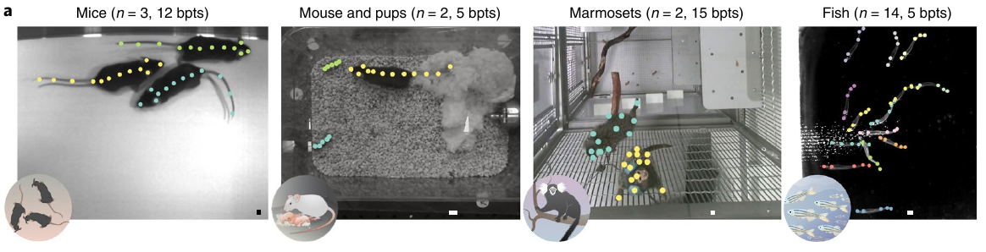
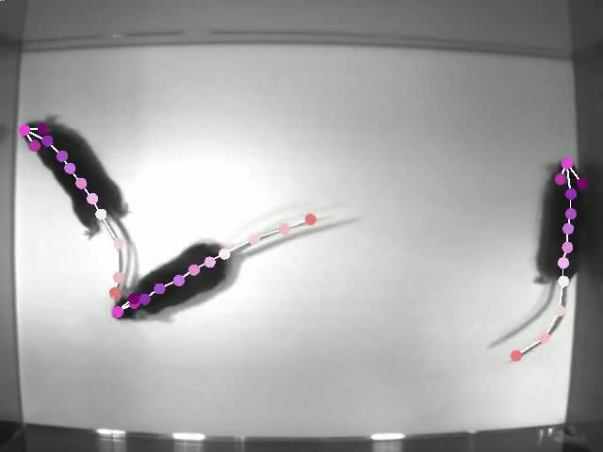
Pose separates body configuration from location
Pose estimation measures the positions of selected body landmarks, such as the snout, paws or tail. A single center point reports where an animal is, but multiple landmarks also describe its orientation and configuration. Lauer and colleagues developed multi-animal DeepLabCut to recover those landmarks in animals sharing a recording.
Their open-field mouse data included close approaches, contact and overlapping bodies. Detecting a paw was only one part of the task: the system also had to assign that paw to the correct mouse. Instance assembly groups detected landmarks into separate animal bodies within each frame.
The original supplementary recording contains predicted poses during movement and contact. Landmark trajectories preserve changes in body configuration that a center-point trajectory discards. Distinguishing localization, assembly and identity makes each stage of the behavioral measurement separately testable.
Lauer et al. (2022), Fig. 1(a). Annotated mice, marmosets and schooling fish.
Lauer et al. (2022), Supplementary Video 1. Tri-mouse pose predictions.
Lauer et al. (2022)
07
Notes:
• Pose estimation measures the positions of selected body landmarks, such as the snout, paws or tail. A single center point reports where an animal is, but multiple landmarks also describe its orientation and configuration. Lauer and colleagues developed multi-animal DeepLabCut to recover those landmarks in animals sharing a recording.
• Their open-field mouse data included close approaches, contact and overlapping bodies. Detecting a paw was only one part of the task: the system also had to assign that paw to the correct mouse. Instance assembly groups detected landmarks into separate animal bodies within each frame.
• The original supplementary recording contains predicted poses during movement and contact. Landmark trajectories preserve changes in body configuration that a center-point trajectory discards. Distinguishing localization, assembly and identity makes each stage of the behavioral measurement separately testable.
References:
Lauer J, Zhou M, Ye S, Menegas W, Schneider S, Nath T, Rahman MM, Di Santo V, Soberanes D, Feng G, Murthy VN, Lauder G, Dulac C, Mathis MW, Mathis A (2022). Multi-animal pose estimation, identification and tracking with DeepLabCut. Nature Methods 19:496-504. https://doi.org/10.1038/s41592-022-01443-0
Figure: Lauer et al. (2022), Fig. 1(a). Annotated mice, marmosets and schooling fish.
Figure source: https://doi.org/10.1038/s41592-022-01443-0
Article-provided recording:
Lauer et al. (2022), Supplementary Video 1. Tri-mouse pose predictions.
Article DOI: https://doi.org/10.1038/s41592-022-01443-0
Original media: https://media.springernature.com/original/springer-static/esm/art%3A10.1038%2Fs41592-022-01443-0/MediaObjects/41592_2022_1443_MOESM3_ESM.mov
Original filename: 41592_2022_1443_MOESM3_ESM.mov
Credit: Lauer et al. and the original study authors; Nature Methods
License: CC BY 4.0, original article supplementary material
H.264 at original dimensions, original timestamps and frame sequence; no crop, recoloring, overlays or speed change. Audio copied if present. Unedited source frame used as poster.
Click the recording in PowerPoint Slide Show for full-screen playback. The separate figure remains the credited static evidence. Embedded relationships and full media decoding were verified; PowerPoint GUI playback was unavailable. Google Slides imports can omit embedded videos: upload the separately supplied MP4 to Drive and insert it as a video. The PDF preview is static.

Slide 8
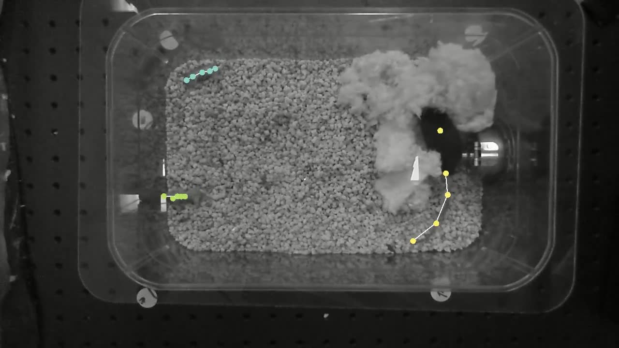
Parenting creates overlap between unlike bodies
A parenting mouse and its pups differ substantially in size and posture. The parenting dataset used separate landmark sets for the adult and the pups, rather than imposing the adult body description on every animal. Body definitions therefore reflected the visible anatomy of the individuals being tracked.
Contact with pups and the nesting material obscured landmarks. Occlusion occurs when another object or body blocks a feature from the camera. The system combined detected parts with evidence about their connections, allowing visible fragments to contribute to an assembled body instead of requiring a complete unobstructed silhouette.
The article-provided parenting recording retains the nest, adult and pups in the scene. These interactions make the distinction between an absent detection and an absent animal biologically consequential: a hidden pup remains in the nest even when its full body cannot be localized in that frame.
Lauer et al. (2022), Fig. 1(a). Parenting mice among the annotated datasets.
Lauer et al. (2022), Supplementary Video 2. Parenting mouse and pup predictions.
Lauer et al. (2022)
08
Notes:
• A parenting mouse and its pups differ substantially in size and posture. The parenting dataset used separate landmark sets for the adult and the pups, rather than imposing the adult body description on every animal. Body definitions therefore reflected the visible anatomy of the individuals being tracked.
• Contact with pups and the nesting material obscured landmarks. Occlusion occurs when another object or body blocks a feature from the camera. The system combined detected parts with evidence about their connections, allowing visible fragments to contribute to an assembled body instead of requiring a complete unobstructed silhouette.
• The article-provided parenting recording retains the nest, adult and pups in the scene. These interactions make the distinction between an absent detection and an absent animal biologically consequential: a hidden pup remains in the nest even when its full body cannot be localized in that frame.
References:
Lauer J, Zhou M, Ye S, Menegas W, Schneider S, Nath T, Rahman MM, Di Santo V, Soberanes D, Feng G, Murthy VN, Lauder G, Dulac C, Mathis MW, Mathis A (2022). Multi-animal pose estimation, identification and tracking with DeepLabCut. Nature Methods 19:496-504. https://doi.org/10.1038/s41592-022-01443-0
Figure: Lauer et al. (2022), Fig. 1(a). Parenting mice among the annotated datasets.
Figure source: https://doi.org/10.1038/s41592-022-01443-0
Article-provided recording:
Lauer et al. (2022), Supplementary Video 2. Parenting mouse and pup predictions.
Article DOI: https://doi.org/10.1038/s41592-022-01443-0
Original media: https://media.springernature.com/original/springer-static/esm/art%3A10.1038%2Fs41592-022-01443-0/MediaObjects/41592_2022_1443_MOESM4_ESM.mp4
Original filename: 41592_2022_1443_MOESM4_ESM.mp4
Credit: Lauer et al. and the original study authors; Nature Methods
License: CC BY 4.0, original article supplementary material
H.264 at original dimensions, original timestamps and frame sequence; no crop, recoloring, overlays or speed change. Audio copied if present. Unedited source frame used as poster.
Click the recording in PowerPoint Slide Show for full-screen playback. The separate figure remains the credited static evidence. Embedded relationships and full media decoding were verified; PowerPoint GUI playback was unavailable. Google Slides imports can omit embedded videos: upload the separately supplied MP4 to Drive and insert it as a video. The PDF preview is static.

Slide 9
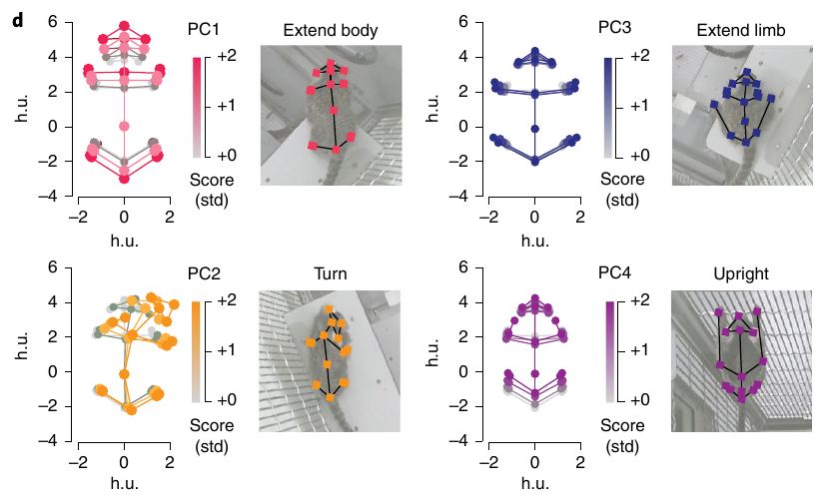
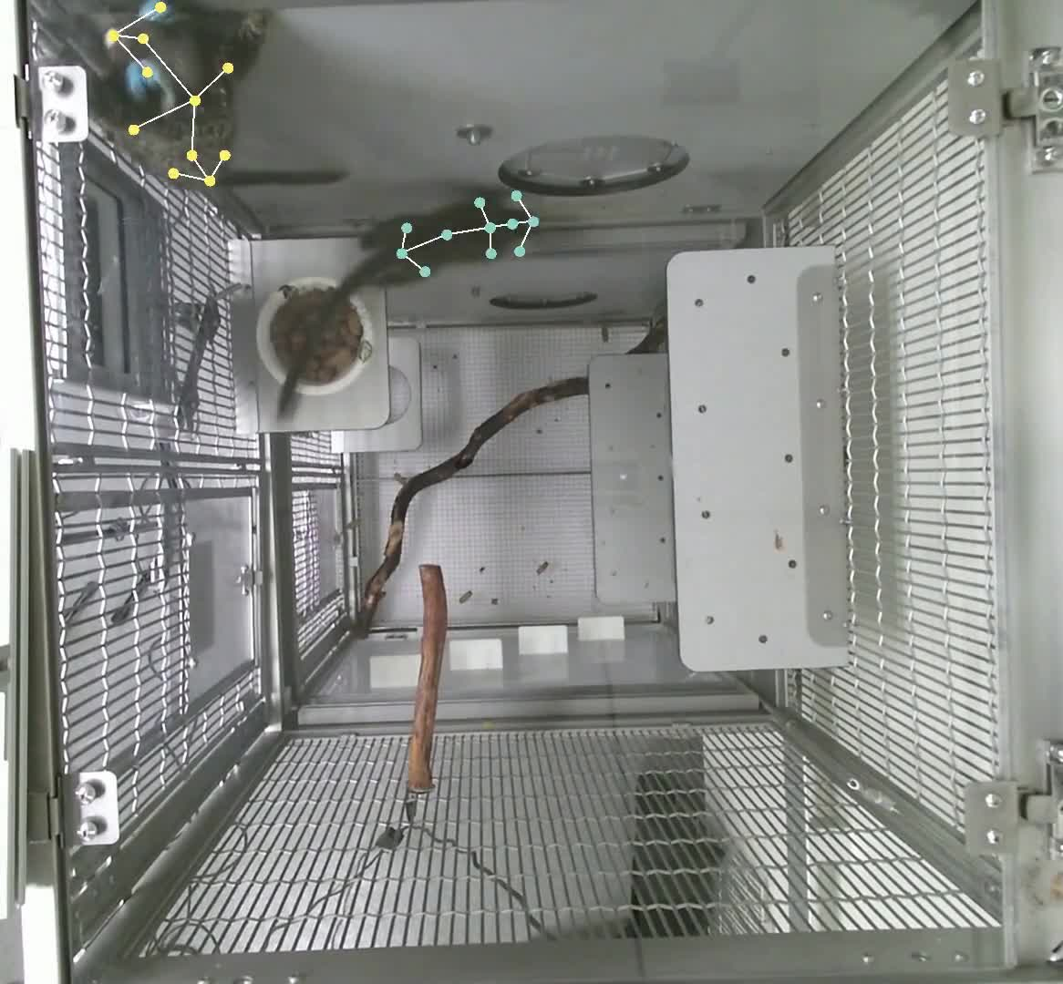
Appearance helps preserve identity during social contact
Individual identity connects an animal’s pose in one frame to that same animal in later frames. Lauer and colleagues tracked pairs of marmosets in an enclosure with changing positions, postures and occasional occlusion. Visible appearance provided information in addition to the expected location of the animal.
Identity predictions were more reliable near the head than at distal body parts. A hand can cross another animal’s body, while head features retain more distinctive appearance. Identity evidence consequently varies across the body instead of being equally informative at every detected landmark.
The study related each marmoset’s posture to the position of its partner. Body-centered coordinates expressed where one animal stood relative to the other, separating their social arrangement from their absolute cage locations. Persistent identities allowed those spatial relationships to be assigned to the correct individuals over time.
Lauer et al. (2022), Fig. 5(d). Marmoset body postures and original landmark assignments.
Lauer et al. (2022), Supplementary Video 3. Marmoset pose predictions.
Lauer et al. (2022)
09
Notes:
• Individual identity connects an animal’s pose in one frame to that same animal in later frames. Lauer and colleagues tracked pairs of marmosets in an enclosure with changing positions, postures and occasional occlusion. Visible appearance provided information in addition to the expected location of the animal.
• Identity predictions were more reliable near the head than at distal body parts. A hand can cross another animal’s body, while head features retain more distinctive appearance. Identity evidence consequently varies across the body instead of being equally informative at every detected landmark.
• The study related each marmoset’s posture to the position of its partner. Body-centered coordinates expressed where one animal stood relative to the other, separating their social arrangement from their absolute cage locations. Persistent identities allowed those spatial relationships to be assigned to the correct individuals over time.
References:
Lauer J, Zhou M, Ye S, Menegas W, Schneider S, Nath T, Rahman MM, Di Santo V, Soberanes D, Feng G, Murthy VN, Lauder G, Dulac C, Mathis MW, Mathis A (2022). Multi-animal pose estimation, identification and tracking with DeepLabCut. Nature Methods 19:496-504. https://doi.org/10.1038/s41592-022-01443-0
Figure: Lauer et al. (2022), Fig. 5(d). Marmoset body postures and original landmark assignments.
Figure source: https://doi.org/10.1038/s41592-022-01443-0
Article-provided recording:
Lauer et al. (2022), Supplementary Video 3. Marmoset pose predictions.
Article DOI: https://doi.org/10.1038/s41592-022-01443-0
Original media: https://media.springernature.com/original/springer-static/esm/art%3A10.1038%2Fs41592-022-01443-0/MediaObjects/41592_2022_1443_MOESM5_ESM.mp4
Original filename: 41592_2022_1443_MOESM5_ESM.mp4
Credit: Lauer et al. and the original study authors; Nature Methods
License: CC BY 4.0, original article supplementary material
H.264 at original dimensions, original timestamps and frame sequence; no crop, recoloring, overlays or speed change. Audio copied if present. Unedited source frame used as poster.
Click the recording in PowerPoint Slide Show for full-screen playback. The separate figure remains the credited static evidence. Embedded relationships and full media decoding were verified; PowerPoint GUI playback was unavailable. Google Slides imports can omit embedded videos: upload the separately supplied MP4 to Drive and insert it as a video. The PDF preview is static.

Slide 10
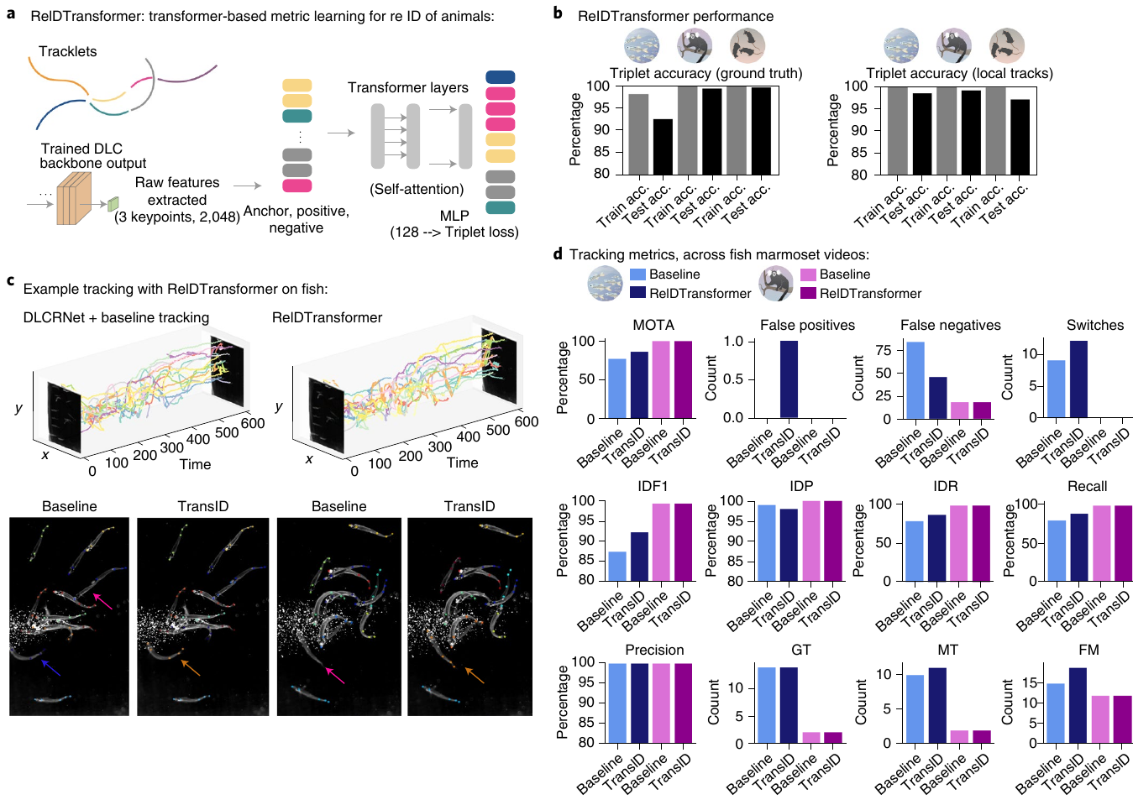
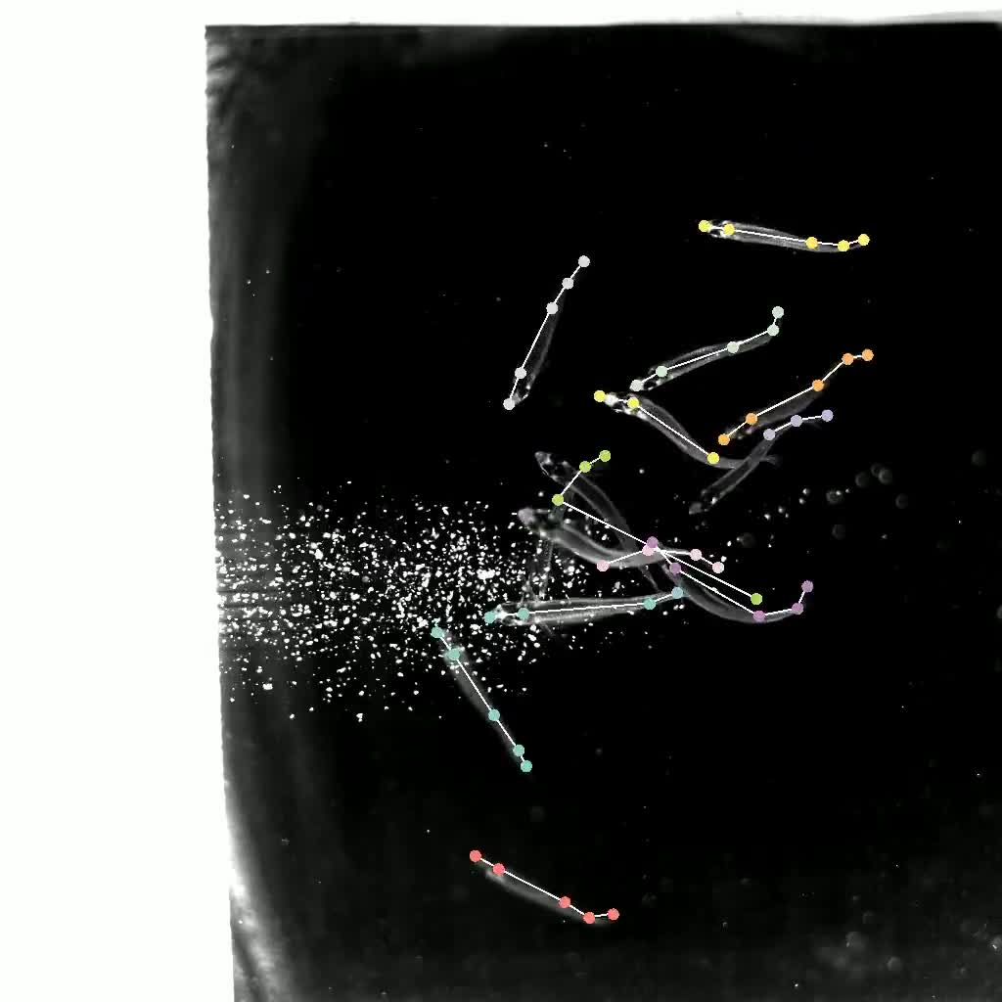
Schooling fish challenge a two-dimensional tracker
Schooling fish move through a three-dimensional tank while a camera records a two-dimensional projection. Fish can overlap in the image without occupying the same depth. Similar appearance and rapid changes in orientation make position alone an unreliable cue for preserving identity during a crossing.
Lauer and colleagues combined locally tracked body poses with re-identification, a method that matches the same individual across interrupted tracks. A learned representation of appearance helped link separated observations. Crowded frames tested the method under conditions in which animals were difficult to distinguish.
The supplied fish recording contains the original tracking predictions during schooling. Short fragments can retain useful movement information even when a full continuous identity track is interrupted. Reconnecting fragments improves the assignment of later movements to the fish that produced the earlier movements.
Lauer et al. (2022), Fig. 4. Re-identification during crowded fish recordings.
Lauer et al. (2022), Supplementary Video 4. Schooling fish pose predictions.
Lauer et al. (2022)
10
Notes:
• Schooling fish move through a three-dimensional tank while a camera records a two-dimensional projection. Fish can overlap in the image without occupying the same depth. Similar appearance and rapid changes in orientation make position alone an unreliable cue for preserving identity during a crossing.
• Lauer and colleagues combined locally tracked body poses with re-identification, a method that matches the same individual across interrupted tracks. A learned representation of appearance helped link separated observations. Crowded frames tested the method under conditions in which animals were difficult to distinguish.
• The supplied fish recording contains the original tracking predictions during schooling. Short fragments can retain useful movement information even when a full continuous identity track is interrupted. Reconnecting fragments improves the assignment of later movements to the fish that produced the earlier movements.
References:
Lauer J, Zhou M, Ye S, Menegas W, Schneider S, Nath T, Rahman MM, Di Santo V, Soberanes D, Feng G, Murthy VN, Lauder G, Dulac C, Mathis MW, Mathis A (2022). Multi-animal pose estimation, identification and tracking with DeepLabCut. Nature Methods 19:496-504. https://doi.org/10.1038/s41592-022-01443-0
Figure: Lauer et al. (2022), Fig. 4. Re-identification during crowded fish recordings.
Figure source: https://doi.org/10.1038/s41592-022-01443-0
Article-provided recording:
Lauer et al. (2022), Supplementary Video 4. Schooling fish pose predictions.
Article DOI: https://doi.org/10.1038/s41592-022-01443-0
Original media: https://media.springernature.com/original/springer-static/esm/art%3A10.1038%2Fs41592-022-01443-0/MediaObjects/41592_2022_1443_MOESM6_ESM.m4v
Original filename: 41592_2022_1443_MOESM6_ESM.m4v
Credit: Lauer et al. and the original study authors; Nature Methods
License: CC BY 4.0, original article supplementary material
H.264 at original dimensions, original timestamps and frame sequence; no crop, recoloring, overlays or speed change. Audio copied if present. Unedited source frame used as poster.
Click the recording in PowerPoint Slide Show for full-screen playback. The separate figure remains the credited static evidence. Embedded relationships and full media decoding were verified; PowerPoint GUI playback was unavailable. Google Slides imports can omit embedded videos: upload the separately supplied MP4 to Drive and insert it as a video. The PDF preview is static.

Slide 11
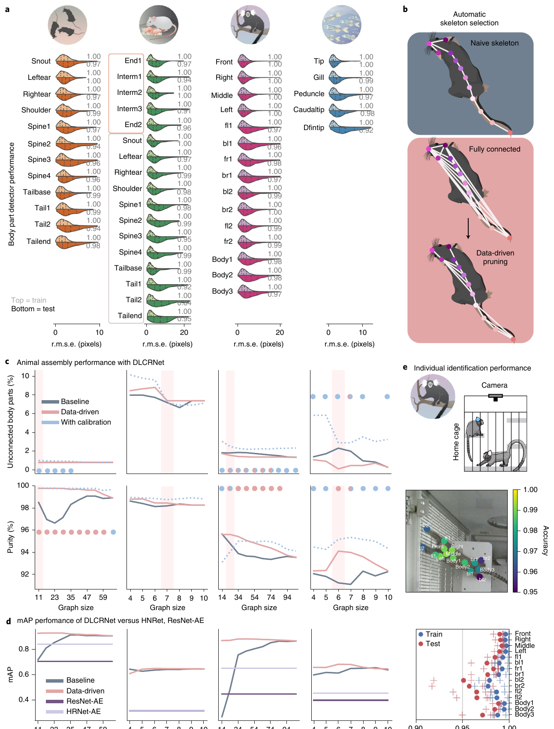
Landmark connections determine whole-body assembly
Part-affinity fields encode the orientation of a connection between two body landmarks. For example, a connection between a shoulder and a hand contributes evidence that the two belong to the same animal. These fields supplement the probability that a landmark occupies a particular image location.
A computational skeleton is the set of landmark connections used for assembly, rather than a reconstruction of bones. The study compared a user-selected graph with data-driven connection selection. Some connections distinguished parts of one animal from neighboring animals more effectively than others.
Choosing informative connections improved assembly while limiting unnecessary comparisons. A collection of accurate landmark detections can still produce an incorrect animal if its parts are grouped wrongly. Evaluating detection and grouping separately exposes that distinction in multi-animal behavioral measurements.
Lauer et al. (2022), Fig. 2. Detection and grouping with alternative landmark graphs.
Lauer et al. (2022)
11
Notes:
• Part-affinity fields encode the orientation of a connection between two body landmarks. For example, a connection between a shoulder and a hand contributes evidence that the two belong to the same animal. These fields supplement the probability that a landmark occupies a particular image location.
• A computational skeleton is the set of landmark connections used for assembly, rather than a reconstruction of bones. The study compared a user-selected graph with data-driven connection selection. Some connections distinguished parts of one animal from neighboring animals more effectively than others.
• Choosing informative connections improved assembly while limiting unnecessary comparisons. A collection of accurate landmark detections can still produce an incorrect animal if its parts are grouped wrongly. Evaluating detection and grouping separately exposes that distinction in multi-animal behavioral measurements.
References:
Lauer J, Zhou M, Ye S, Menegas W, Schneider S, Nath T, Rahman MM, Di Santo V, Soberanes D, Feng G, Murthy VN, Lauder G, Dulac C, Mathis MW, Mathis A (2022). Multi-animal pose estimation, identification and tracking with DeepLabCut. Nature Methods 19:496-504. https://doi.org/10.1038/s41592-022-01443-0
Figure: Lauer et al. (2022), Fig. 2. Detection and grouping with alternative landmark graphs.
Figure source: https://doi.org/10.1038/s41592-022-01443-0

Slide 12
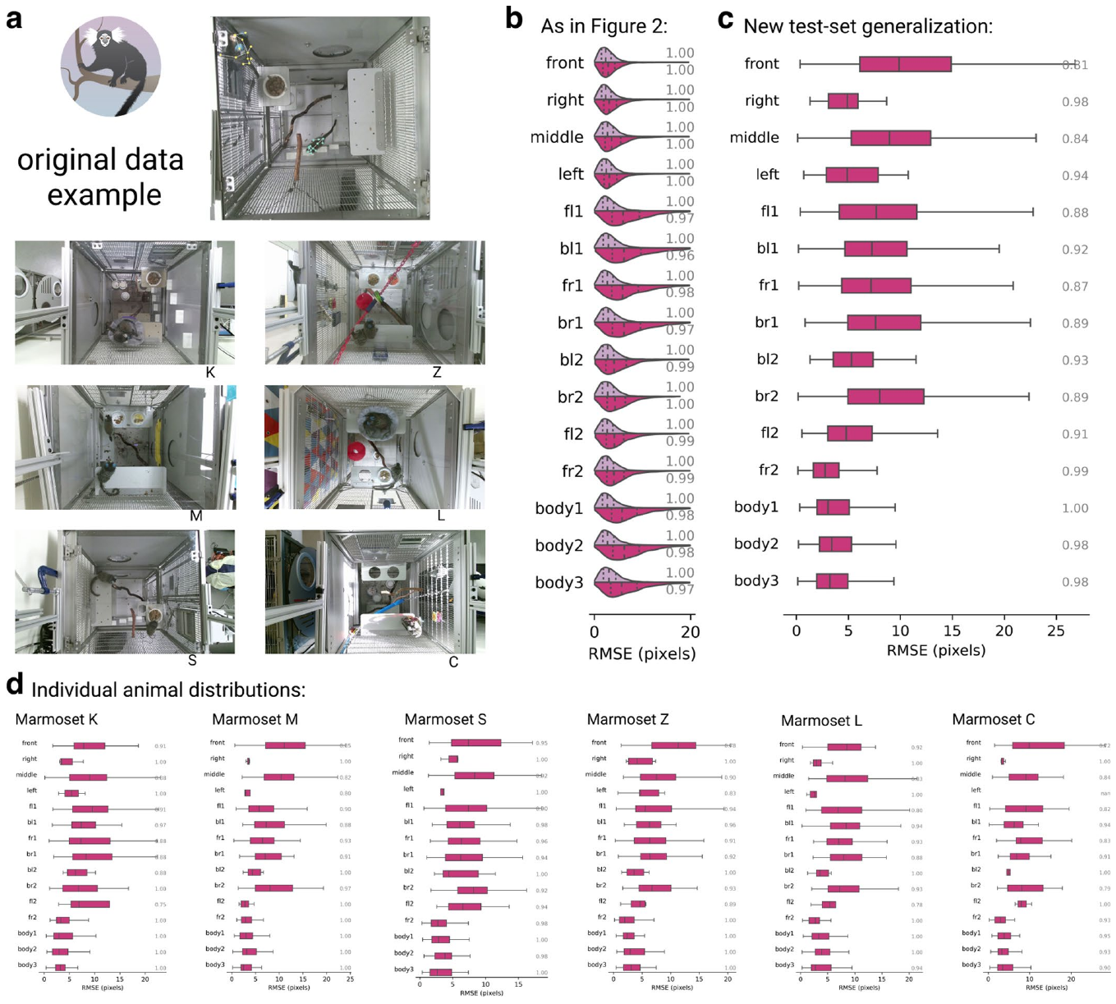
A new cage tests generalization beyond training images
Generalization is performance on conditions outside those used for training. Lauer and colleagues examined marmoset tracking in additional cage environments, where the background, lighting and visible posture could differ from the original annotated data. Testing only neighboring frames from one scene would leave those changes largely unchallenged.
The benchmark measured landmark localization against manually annotated positions. Errors in pixels describe image-space accuracy, but their biological impact depends on animal size and on the behavior being measured. A small displacement at a paw can alter a contact estimate even when the animal’s overall location is accurate.
The study’s datasets included open-field mice, parenting mice, marmosets and fish. Each required annotations matching its recording conditions and body landmarks. Transfer across environments therefore involved validating the measurement in the new scene, rather than assuming that a successful training result established universal performance.
Lauer et al. (2022), Extended Data Fig. 6. Tracking generalization across recording settings.
Lauer et al. (2022)
12
Notes:
• Generalization is performance on conditions outside those used for training. Lauer and colleagues examined marmoset tracking in additional cage environments, where the background, lighting and visible posture could differ from the original annotated data. Testing only neighboring frames from one scene would leave those changes largely unchallenged.
• The benchmark measured landmark localization against manually annotated positions. Errors in pixels describe image-space accuracy, but their biological impact depends on animal size and on the behavior being measured. A small displacement at a paw can alter a contact estimate even when the animal’s overall location is accurate.
• The study’s datasets included open-field mice, parenting mice, marmosets and fish. Each required annotations matching its recording conditions and body landmarks. Transfer across environments therefore involved validating the measurement in the new scene, rather than assuming that a successful training result established universal performance.
References:
Lauer J, Zhou M, Ye S, Menegas W, Schneider S, Nath T, Rahman MM, Di Santo V, Soberanes D, Feng G, Murthy VN, Lauder G, Dulac C, Mathis MW, Mathis A (2022). Multi-animal pose estimation, identification and tracking with DeepLabCut. Nature Methods 19:496-504. https://doi.org/10.1038/s41592-022-01443-0
Figure: Lauer et al. (2022), Extended Data Fig. 6. Tracking generalization across recording settings.
Figure source: https://doi.org/10.1038/s41592-022-01443-0

Slide 13
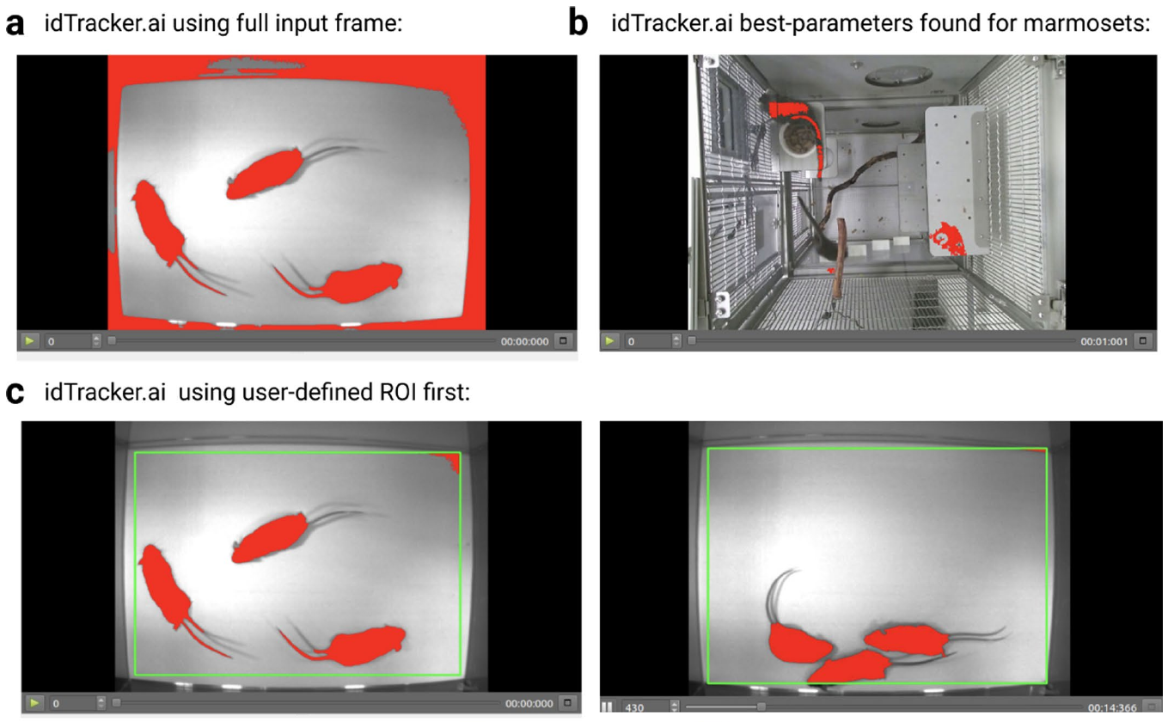
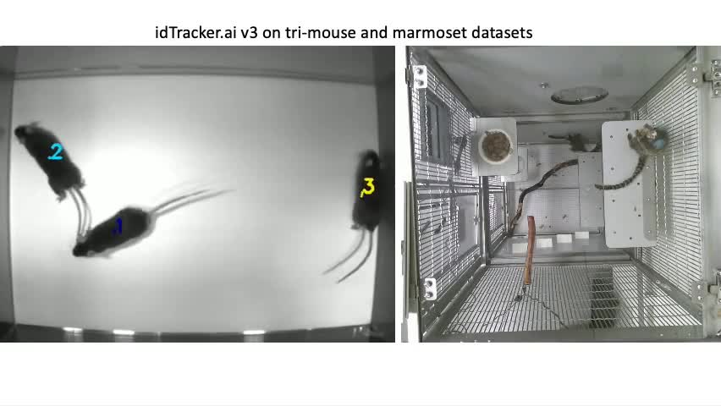
Silhouette tracking fails differently from pose tracking
Segmentation separates an animal’s pixels from the background. A silhouette-based identity tracker depends on that separation before it can describe the animal’s appearance. Nonuniform lighting, enclosure features and overlapping bodies can disrupt segmentation even when a human observer can still recognize the animals.
Lauer and colleagues compared pose tracking with idtracker.ai in the mouse and marmoset recordings. The original comparison movie preserves the competing predictions in their recording contexts. Pose-based detection uses local body-part evidence, whereas silhouette-based tracking first depends on identifying a suitable animal region.
Failure at an early image-processing stage changes the information available to subsequent identity matching. Correcting an identity label cannot restore a body that was not separated from the background. Comparing these failure modes connects the choice of tracking method to the actual scene and social behavior being recorded.
Lauer et al. (2022), Extended Data Fig. 8(a–c). Segmentation in mouse and marmoset recordings.
Lauer et al. (2022), Supplementary Video 5. idtracker.ai on mice and marmosets.
Lauer et al. (2022)
13
Notes:
• Segmentation separates an animal’s pixels from the background. A silhouette-based identity tracker depends on that separation before it can describe the animal’s appearance. Nonuniform lighting, enclosure features and overlapping bodies can disrupt segmentation even when a human observer can still recognize the animals.
• Lauer and colleagues compared pose tracking with idtracker.ai in the mouse and marmoset recordings. The original comparison movie preserves the competing predictions in their recording contexts. Pose-based detection uses local body-part evidence, whereas silhouette-based tracking first depends on identifying a suitable animal region.
• Failure at an early image-processing stage changes the information available to subsequent identity matching. Correcting an identity label cannot restore a body that was not separated from the background. Comparing these failure modes connects the choice of tracking method to the actual scene and social behavior being recorded.
References:
Lauer J, Zhou M, Ye S, Menegas W, Schneider S, Nath T, Rahman MM, Di Santo V, Soberanes D, Feng G, Murthy VN, Lauder G, Dulac C, Mathis MW, Mathis A (2022). Multi-animal pose estimation, identification and tracking with DeepLabCut. Nature Methods 19:496-504. https://doi.org/10.1038/s41592-022-01443-0
Figure: Lauer et al. (2022), Extended Data Fig. 8(a–c). Segmentation in mouse and marmoset recordings.
Figure source: https://doi.org/10.1038/s41592-022-01443-0
Article-provided recording:
Lauer et al. (2022), Supplementary Video 5. idtracker.ai on mice and marmosets.
Article DOI: https://doi.org/10.1038/s41592-022-01443-0
Original media: https://media.springernature.com/original/springer-static/esm/art%3A10.1038%2Fs41592-022-01443-0/MediaObjects/41592_2022_1443_MOESM7_ESM.mp4
Original filename: 41592_2022_1443_MOESM7_ESM.mp4
Credit: Lauer et al. and the original study authors; Nature Methods
License: CC BY 4.0, original article supplementary material
H.264 at original dimensions, original timestamps and frame sequence; no crop, recoloring, overlays or speed change. Audio copied if present. Unedited source frame used as poster.
Click the recording in PowerPoint Slide Show for full-screen playback. The separate figure remains the credited static evidence. Embedded relationships and full media decoding were verified; PowerPoint GUI playback was unavailable. Google Slides imports can omit embedded videos: upload the separately supplied MP4 to Drive and insert it as a video. The PDF preview is static.

Slide 14
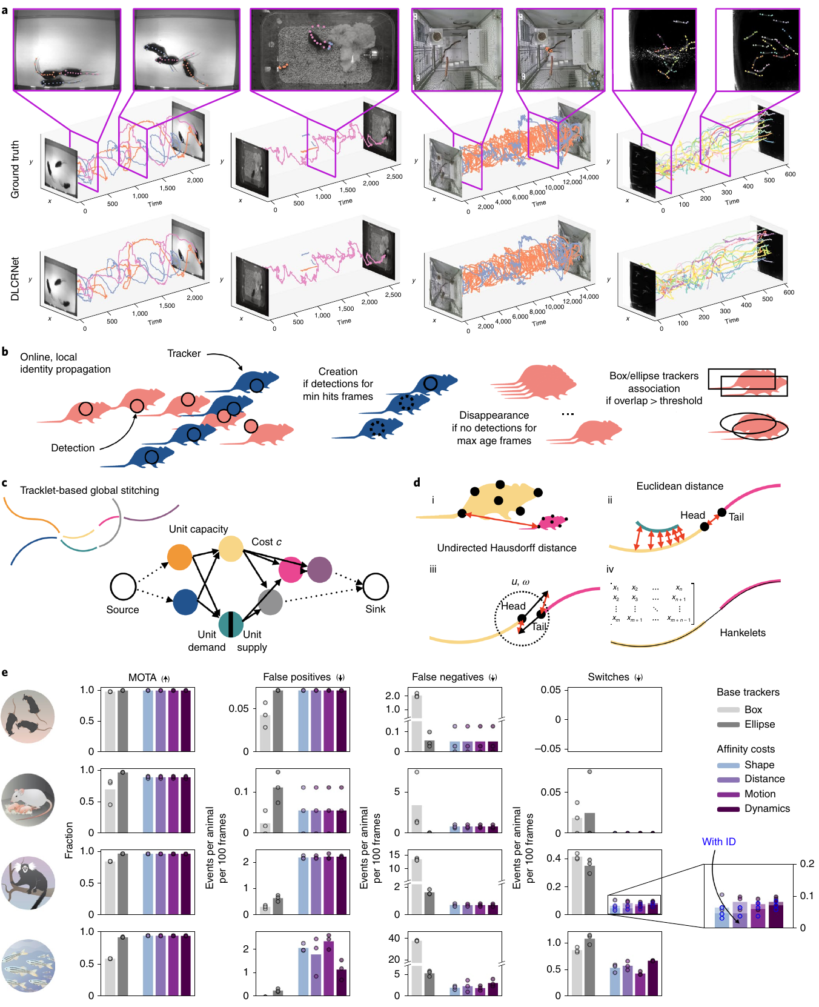
Track fragments require explicit reconnection evidence
A tracklet is a short sequence of detections linked as belonging to one animal. Occlusion can end a tracklet even though the animal remains in the scene. Lauer and colleagues first established local connections between neighboring frames, then evaluated how separated fragments could be reconnected.
The stitching procedure used shape similarity, spatial proximity, movement predictions and similarities in trajectory dynamics. Each supplied a different kind of evidence that two fragments belonged to the same individual. A nearby fragment could still be the wrong match if its shape or movement conflicted with the earlier animal.
The study compared stitched tracks with simpler box and ellipse trackers. Combining fragments improved continuity and reduced identity switches. Explicitly separating local tracking from later stitching made long behavioral records recoverable when uninterrupted frame-to-frame matching failed.
Lauer et al. (2022), Fig. 3(a–e). Ground-truth tracks, reconstructed tracks and local matching.
Lauer et al. (2022)
14
Notes:
• A tracklet is a short sequence of detections linked as belonging to one animal. Occlusion can end a tracklet even though the animal remains in the scene. Lauer and colleagues first established local connections between neighboring frames, then evaluated how separated fragments could be reconnected.
• The stitching procedure used shape similarity, spatial proximity, movement predictions and similarities in trajectory dynamics. Each supplied a different kind of evidence that two fragments belonged to the same individual. A nearby fragment could still be the wrong match if its shape or movement conflicted with the earlier animal.
• The study compared stitched tracks with simpler box and ellipse trackers. Combining fragments improved continuity and reduced identity switches. Explicitly separating local tracking from later stitching made long behavioral records recoverable when uninterrupted frame-to-frame matching failed.
References:
Lauer J, Zhou M, Ye S, Menegas W, Schneider S, Nath T, Rahman MM, Di Santo V, Soberanes D, Feng G, Murthy VN, Lauder G, Dulac C, Mathis MW, Mathis A (2022). Multi-animal pose estimation, identification and tracking with DeepLabCut. Nature Methods 19:496-504. https://doi.org/10.1038/s41592-022-01443-0
Figure: Lauer et al. (2022), Fig. 3(a–e). Ground-truth tracks, reconstructed tracks and local matching.
Figure source: https://doi.org/10.1038/s41592-022-01443-0

Slide 15
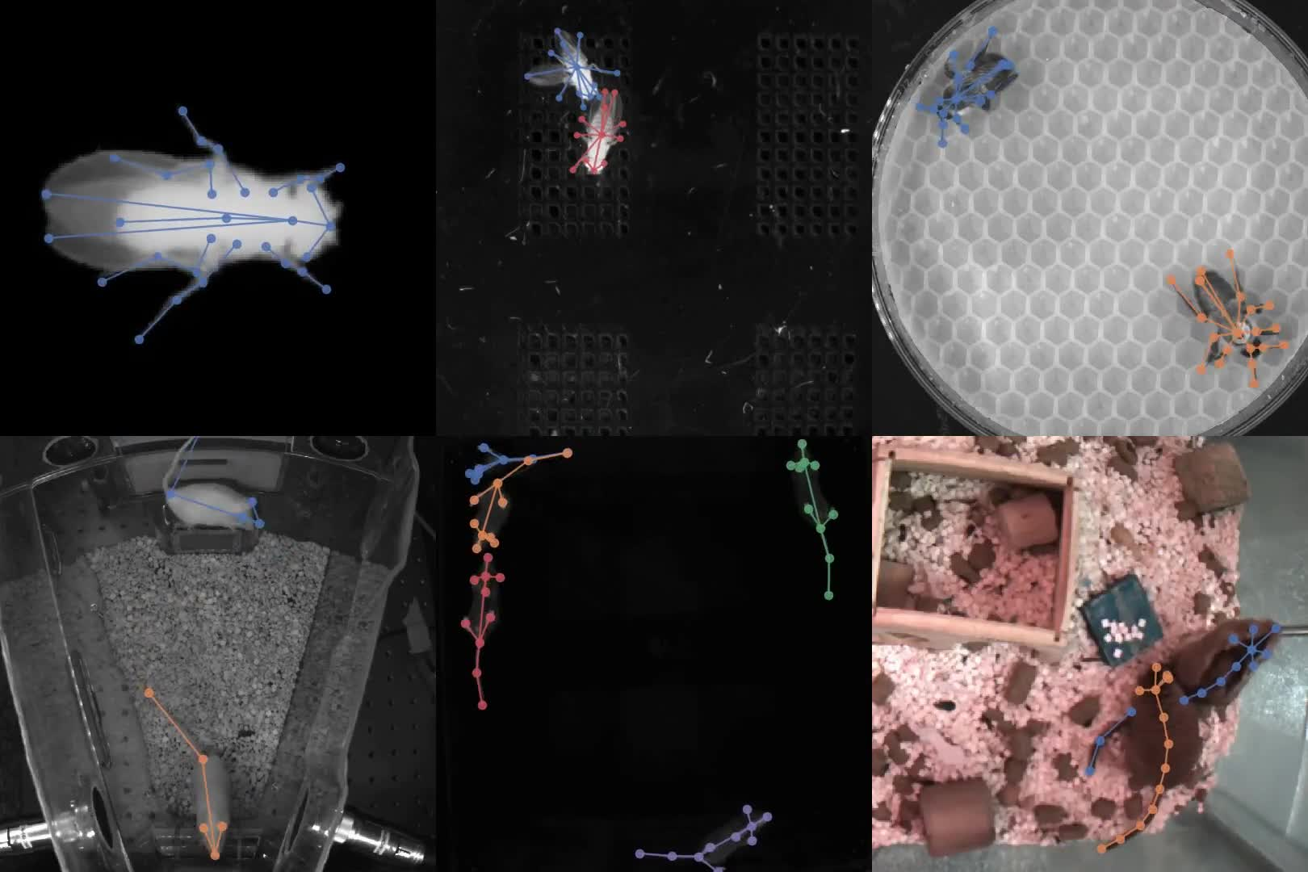
A shared tracking system needs different body definitions
Pereira and colleagues developed SLEAP, a system for multi-animal pose tracking across different recording preparations. Fly courtship, bees on a honeycomb floor, open-field mice and home-cage animals presented different body forms, textures and camera views. The shared software operated on landmark definitions selected for each dataset.
The recorded body landmarks described anatomical locations rather than a universal list of points. A bee’s body and appendages required a different annotation scheme from a mouse viewed from below. Camera orientation also changed which features were visible and which could support a reliable measurement.
The original supplementary video contains predictions across these preparations before manual proofreading. The output preserves both successful tracking and errors. Cross-species automation therefore combines a common computational procedure with species- and view-specific definitions of the behaviorally relevant body features.
Pereira et al. (2022), Extended Data Fig. 1(a–f). Flies, bees, mice and gerbils in their recording settings.
Pereira et al. (2022), Supplementary Video 1. Uncorrected predictions across species.
Pereira et al. (2022)
15
Notes:
• Pereira and colleagues developed SLEAP, a system for multi-animal pose tracking across different recording preparations. Fly courtship, bees on a honeycomb floor, open-field mice and home-cage animals presented different body forms, textures and camera views. The shared software operated on landmark definitions selected for each dataset.
• The recorded body landmarks described anatomical locations rather than a universal list of points. A bee’s body and appendages required a different annotation scheme from a mouse viewed from below. Camera orientation also changed which features were visible and which could support a reliable measurement.
• The original supplementary video contains predictions across these preparations before manual proofreading. The output preserves both successful tracking and errors. Cross-species automation therefore combines a common computational procedure with species- and view-specific definitions of the behaviorally relevant body features.
References:
Pereira TD, Tabris N, Matsliah A, Turner DM, Li J, Ravindranath S, Papadoyannis ES, Normand E, Deutsch DS, Wang ZY, McKenzie-Smith GC, Mitelut CC, Castro MD, D’Uva J, Kislin M, Sanes DH, Kocher SD, Wang SSH, Falkner AL, Shaevitz JW, Murthy M (2022). SLEAP: A deep learning system for multi-animal pose tracking. Nature Methods 19:486-495. https://doi.org/10.1038/s41592-022-01426-1
Figure: Pereira et al. (2022), Extended Data Fig. 1(a–f). Flies, bees, mice and gerbils in their recording settings.
Figure source: https://doi.org/10.1038/s41592-022-01426-1
Article-provided recording:
Pereira et al. (2022), Supplementary Video 1. Uncorrected predictions across species.
Article DOI: https://doi.org/10.1038/s41592-022-01426-1
Original media: https://media.springernature.com/original/springer-static/esm/art%3A10.1038%2Fs41592-022-01426-1/MediaObjects/41592_2022_1426_MOESM4_ESM.mp4
Original filename: 41592_2022_1426_MOESM4_ESM.mp4
Credit: Pereira et al. and the original study authors; Nature Methods
License: CC BY 4.0, original article supplementary material
H.264 at original dimensions, original timestamps and frame sequence; no crop, recoloring, overlays or speed change. Audio copied if present. Unedited source frame used as poster.
Click the recording in PowerPoint Slide Show for full-screen playback. The separate figure remains the credited static evidence. Embedded relationships and full media decoding were verified; PowerPoint GUI playback was unavailable. Google Slides imports can omit embedded videos: upload the separately supplied MP4 to Drive and insert it as a video. The PDF preview is static.

Slide 16
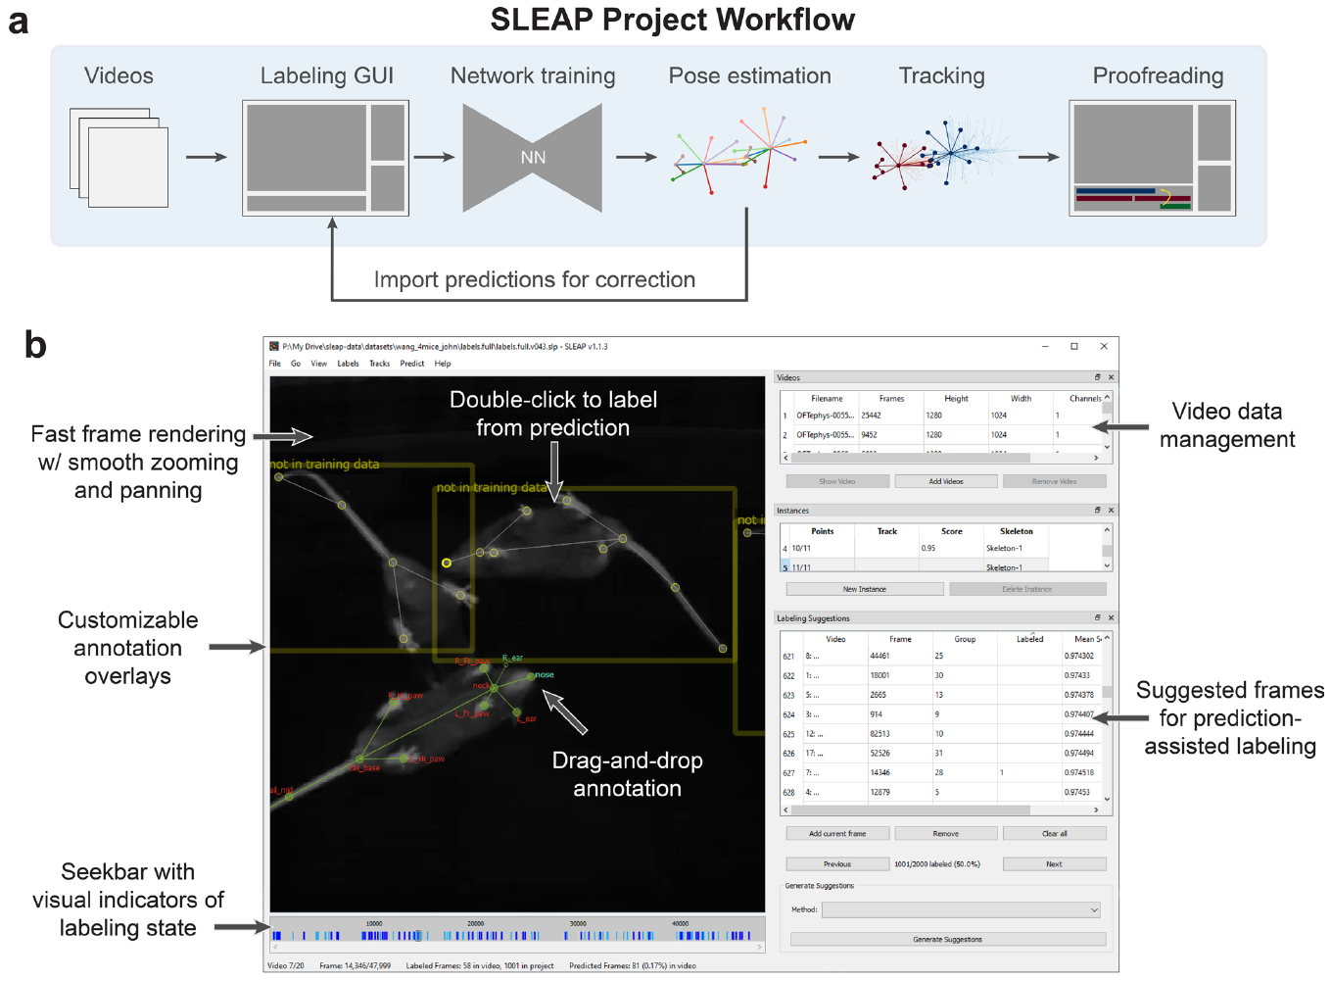
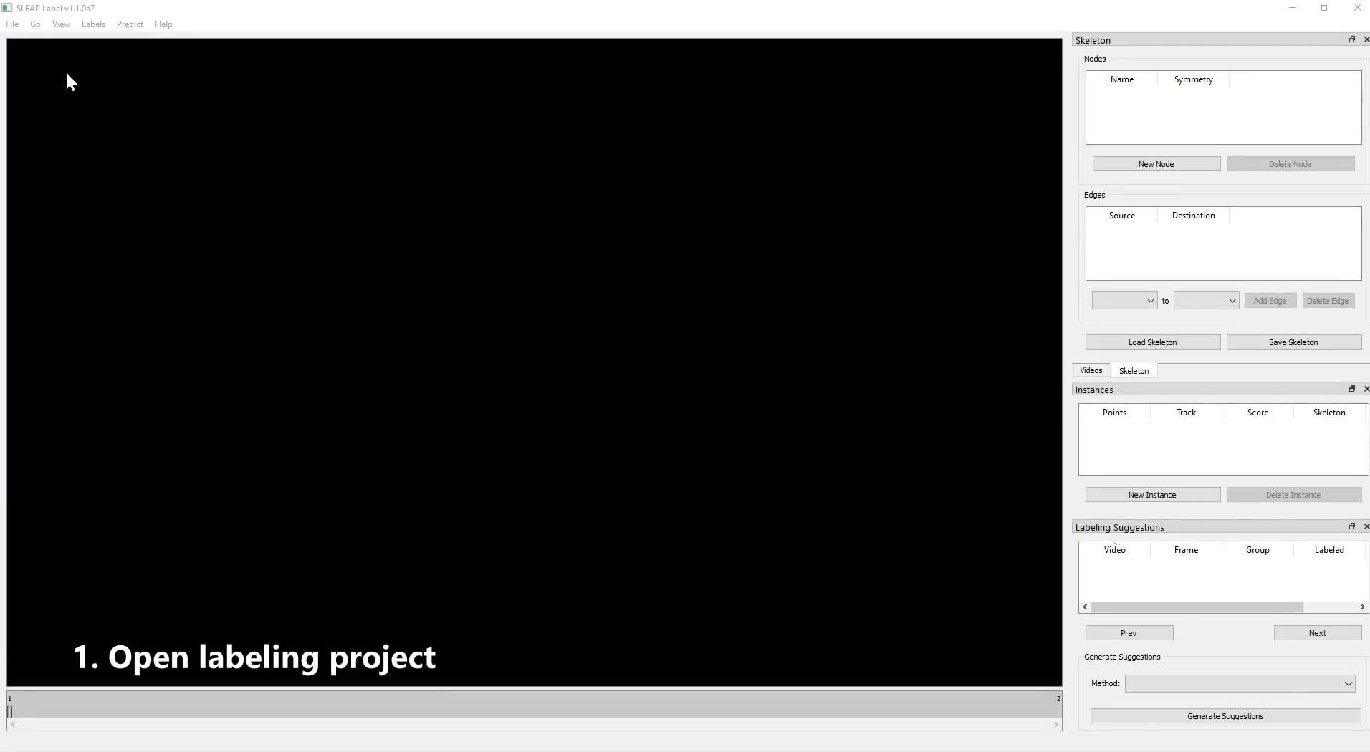
Human labels define what the computer learns to measure
Annotation assigns named landmarks to visible locations in a recorded frame. In SLEAP, a researcher labels selected images, trains a model and then inspects its predictions. The supplied labeling-workflow recording documents that sequence using the authors’ own interface and animal footage.
Labels need consistent anatomical meaning across changes in posture. A left-side landmark remains associated with the animal’s left side even when its projected position crosses the image midline. Visibility and occlusion also require consistent handling so that uncertain locations are not treated as reliable observations.
Model-assisted labeling uses predicted landmarks as an editable starting point for additional training frames. Correcting mistakes supplies examples from difficult scenes rather than repeatedly labeling only easy poses. The measurement definition remains grounded in the anatomical assignments made by the researcher.
Pereira et al. (2022), Extended Data Fig. 2. The original annotation interface and body landmarks.
Pereira et al. (2022), Supplementary Video 2. Original labeling-session screencast.
Pereira et al. (2022)
16
Notes:
• Annotation assigns named landmarks to visible locations in a recorded frame. In SLEAP, a researcher labels selected images, trains a model and then inspects its predictions. The supplied labeling-workflow recording documents that sequence using the authors’ own interface and animal footage.
• Labels need consistent anatomical meaning across changes in posture. A left-side landmark remains associated with the animal’s left side even when its projected position crosses the image midline. Visibility and occlusion also require consistent handling so that uncertain locations are not treated as reliable observations.
• Model-assisted labeling uses predicted landmarks as an editable starting point for additional training frames. Correcting mistakes supplies examples from difficult scenes rather than repeatedly labeling only easy poses. The measurement definition remains grounded in the anatomical assignments made by the researcher.
References:
Pereira TD, Tabris N, Matsliah A, Turner DM, Li J, Ravindranath S, Papadoyannis ES, Normand E, Deutsch DS, Wang ZY, McKenzie-Smith GC, Mitelut CC, Castro MD, D’Uva J, Kislin M, Sanes DH, Kocher SD, Wang SSH, Falkner AL, Shaevitz JW, Murthy M (2022). SLEAP: A deep learning system for multi-animal pose tracking. Nature Methods 19:486-495. https://doi.org/10.1038/s41592-022-01426-1
Figure: Pereira et al. (2022), Extended Data Fig. 2. The original annotation interface and body landmarks.
Figure source: https://doi.org/10.1038/s41592-022-01426-1
Article-provided recording:
Pereira et al. (2022), Supplementary Video 2. Original labeling-session screencast.
Article DOI: https://doi.org/10.1038/s41592-022-01426-1
Original media: https://media.springernature.com/original/springer-static/esm/art%3A10.1038%2Fs41592-022-01426-1/MediaObjects/41592_2022_1426_MOESM5_ESM.mp4
Original filename: 41592_2022_1426_MOESM5_ESM.mp4
Credit: Pereira et al. and the original study authors; Nature Methods
License: CC BY 4.0, original article supplementary material
H.264 at original dimensions, original timestamps and frame sequence; no crop, recoloring, overlays or speed change. Audio copied if present. Unedited source frame used as poster.
Click the recording in PowerPoint Slide Show for full-screen playback. The separate figure remains the credited static evidence. Embedded relationships and full media decoding were verified; PowerPoint GUI playback was unavailable. Google Slides imports can omit embedded videos: upload the separately supplied MP4 to Drive and insert it as a video. The PDF preview is static.

Slide 17
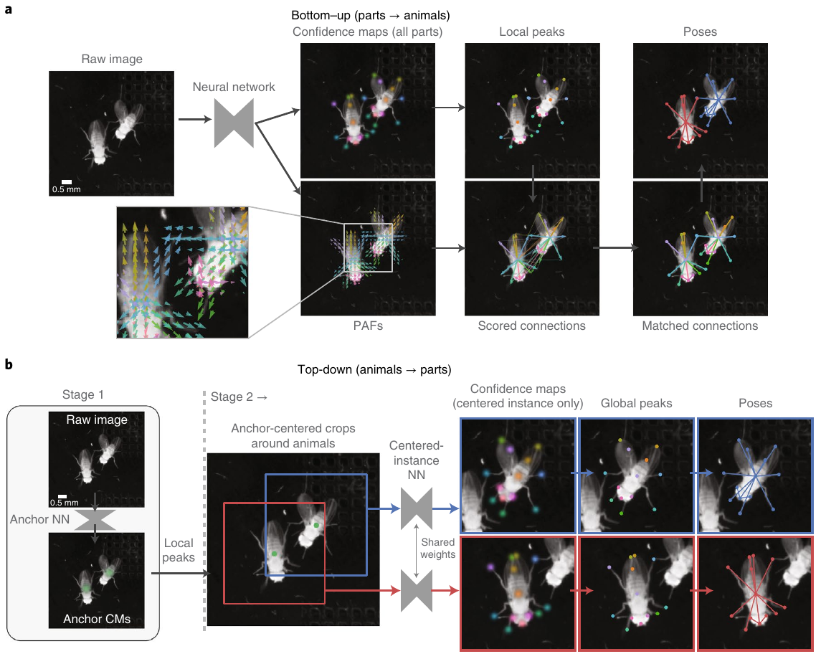
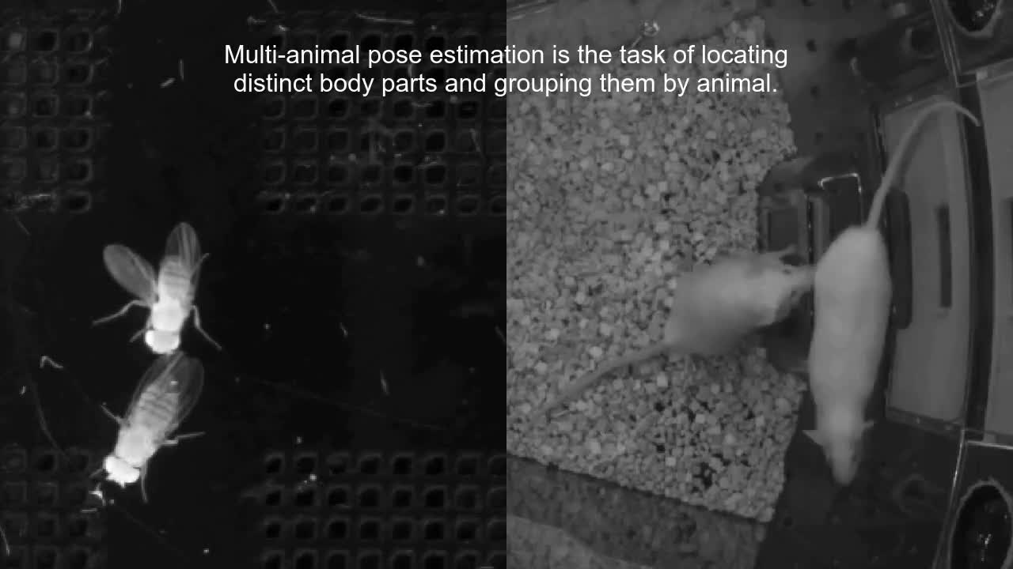
Grouping can precede or follow animal localization
SLEAP implements bottom-up and top-down pose estimation. A bottom-up model detects body parts across the entire frame, then groups the parts into animals using connection evidence. A top-down model first locates an anchor for each animal, then estimates its body parts within a crop centered on that animal.
Top-down inference repeats the second stage for each detected individual. Its computational cost therefore increases with the number of animals. Bottom-up inference processes the full scene in one main detection stage, although assembling the resulting landmarks also consumes computation.
The study compared both approaches on held-out animal images. Their relative performance depended on the dataset, including body appearance, clutter and animal count. The authors’ original methods movie traces these processing stages, linking the order of computations to the grouping problems encountered in real recordings.
Pereira et al. (2022), Fig. 3(a–b). Bottom-up and top-down pose processing stages.
Pereira et al. (2022), Supplementary Video 3. Original authors’ pose-processing explanation.
Pereira et al. (2022)
17
Notes:
• SLEAP implements bottom-up and top-down pose estimation. A bottom-up model detects body parts across the entire frame, then groups the parts into animals using connection evidence. A top-down model first locates an anchor for each animal, then estimates its body parts within a crop centered on that animal.
• Top-down inference repeats the second stage for each detected individual. Its computational cost therefore increases with the number of animals. Bottom-up inference processes the full scene in one main detection stage, although assembling the resulting landmarks also consumes computation.
• The study compared both approaches on held-out animal images. Their relative performance depended on the dataset, including body appearance, clutter and animal count. The authors’ original methods movie traces these processing stages, linking the order of computations to the grouping problems encountered in real recordings.
References:
Pereira TD, Tabris N, Matsliah A, Turner DM, Li J, Ravindranath S, Papadoyannis ES, Normand E, Deutsch DS, Wang ZY, McKenzie-Smith GC, Mitelut CC, Castro MD, D’Uva J, Kislin M, Sanes DH, Kocher SD, Wang SSH, Falkner AL, Shaevitz JW, Murthy M (2022). SLEAP: A deep learning system for multi-animal pose tracking. Nature Methods 19:486-495. https://doi.org/10.1038/s41592-022-01426-1
Figure: Pereira et al. (2022), Fig. 3(a–b). Bottom-up and top-down pose processing stages.
Figure source: https://doi.org/10.1038/s41592-022-01426-1
Article-provided recording:
Pereira et al. (2022), Supplementary Video 3. Original authors’ pose-processing explanation.
Article DOI: https://doi.org/10.1038/s41592-022-01426-1
Original media: https://media.springernature.com/original/springer-static/esm/art%3A10.1038%2Fs41592-022-01426-1/MediaObjects/41592_2022_1426_MOESM6_ESM.mp4
Original filename: 41592_2022_1426_MOESM6_ESM.mp4
Credit: Pereira et al. and the original study authors; Nature Methods
License: CC BY 4.0, original article supplementary material
H.264 at original dimensions, original timestamps and frame sequence; no crop, recoloring, overlays or speed change. Audio copied if present. Unedited source frame used as poster.
Click the recording in PowerPoint Slide Show for full-screen playback. The separate figure remains the credited static evidence. Embedded relationships and full media decoding were verified; PowerPoint GUI playback was unavailable. Google Slides imports can omit embedded videos: upload the separately supplied MP4 to Drive and insert it as a video. The PDF preview is static.

Slide 18
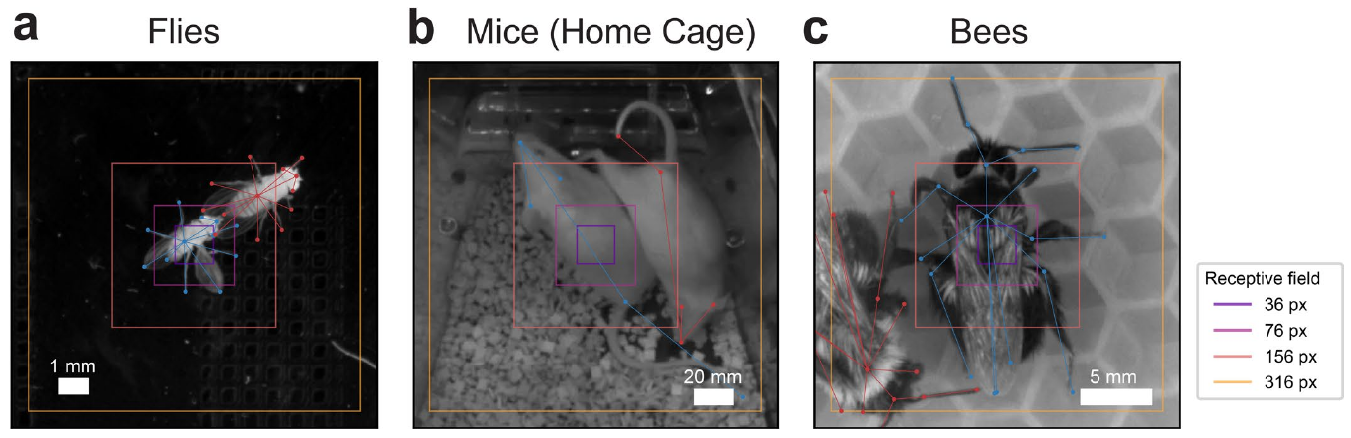
Visual context changes landmark recognition
A network’s receptive field is the region of input pixels that can influence a particular output. A very small field may contain a leg segment without enough neighboring anatomy to identify which leg it is. Increasing context allows the model to use the surrounding body configuration.
SLEAP varied receptive-field size and measured pose-estimation accuracy in flies, mice and bees. Optimal sizes differed among datasets. Body scale, magnification and the distance between landmarks changed how much image context was needed to distinguish the relevant parts.
Adding context also increased the computational work of the tested network configurations. Receptive-field choice consequently affected both recognition and processing speed. The published overlays retain the original animal scenes, making the amount of sampled visual context explicit without equating it with an animal’s own sensory field.
Pereira et al. (2022), Extended Data Fig. 4(a–c). Network receptive fields over flies, mice and bees.
Pereira et al. (2022)
18
Notes:
• A network’s receptive field is the region of input pixels that can influence a particular output. A very small field may contain a leg segment without enough neighboring anatomy to identify which leg it is. Increasing context allows the model to use the surrounding body configuration.
• SLEAP varied receptive-field size and measured pose-estimation accuracy in flies, mice and bees. Optimal sizes differed among datasets. Body scale, magnification and the distance between landmarks changed how much image context was needed to distinguish the relevant parts.
• Adding context also increased the computational work of the tested network configurations. Receptive-field choice consequently affected both recognition and processing speed. The published overlays retain the original animal scenes, making the amount of sampled visual context explicit without equating it with an animal’s own sensory field.
References:
Pereira TD, Tabris N, Matsliah A, Turner DM, Li J, Ravindranath S, Papadoyannis ES, Normand E, Deutsch DS, Wang ZY, McKenzie-Smith GC, Mitelut CC, Castro MD, D’Uva J, Kislin M, Sanes DH, Kocher SD, Wang SSH, Falkner AL, Shaevitz JW, Murthy M (2022). SLEAP: A deep learning system for multi-animal pose tracking. Nature Methods 19:486-495. https://doi.org/10.1038/s41592-022-01426-1
Figure: Pereira et al. (2022), Extended Data Fig. 4(a–c). Network receptive fields over flies, mice and bees.
Figure source: https://doi.org/10.1038/s41592-022-01426-1

Slide 19
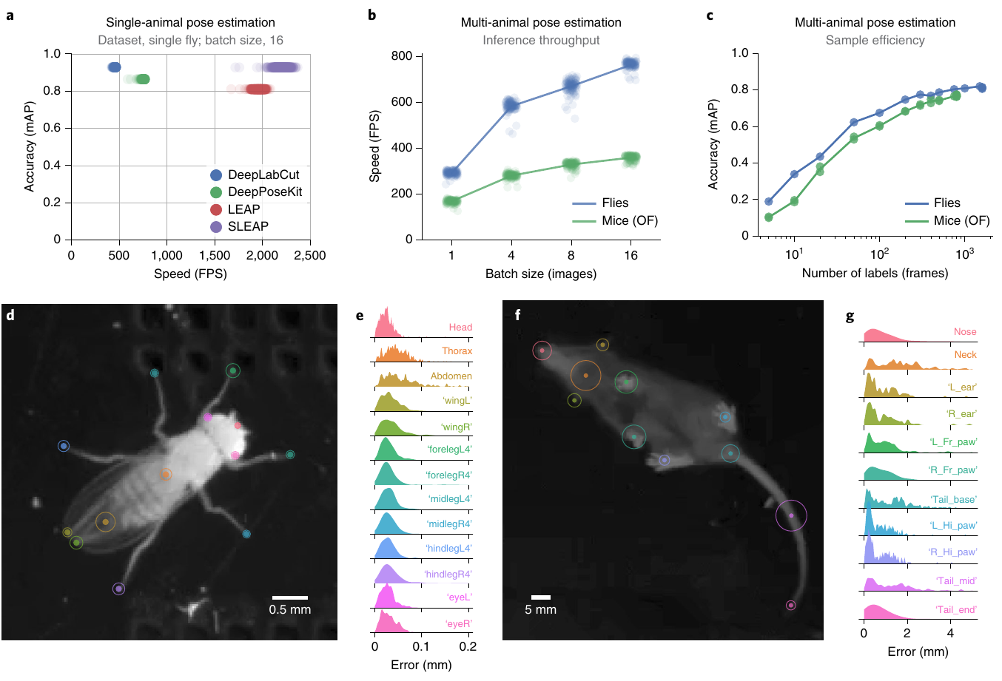
Processing speed must match the behavioral task
Inference is the computation that turns a new image into a model prediction. SLEAP measured inference speed alongside landmark accuracy, because a fast but misplaced body estimate can trigger an experimental event at the wrong location. Conversely, accurate predictions produced too late can miss the relevant action.
Offline processing can use batches of recorded images to improve throughput. A real-time experiment receives new frames sequentially and must act on the current scene. High batch-processing speed therefore differs from the delay between one newly acquired frame and a usable prediction.
The study evaluated body-part errors against held-out manual labels and compared speed across model configurations. Both measurements belonged to the actual recording and computational setup. Selecting a model for a behavioral task required the combination of sufficient anatomical accuracy and timely output.
Pereira et al. (2022), Fig. 2(a–g). Speed, training efficiency and landmark errors.
Pereira et al. (2022)
19
Notes:
• Inference is the computation that turns a new image into a model prediction. SLEAP measured inference speed alongside landmark accuracy, because a fast but misplaced body estimate can trigger an experimental event at the wrong location. Conversely, accurate predictions produced too late can miss the relevant action.
• Offline processing can use batches of recorded images to improve throughput. A real-time experiment receives new frames sequentially and must act on the current scene. High batch-processing speed therefore differs from the delay between one newly acquired frame and a usable prediction.
• The study evaluated body-part errors against held-out manual labels and compared speed across model configurations. Both measurements belonged to the actual recording and computational setup. Selecting a model for a behavioral task required the combination of sufficient anatomical accuracy and timely output.
References:
Pereira TD, Tabris N, Matsliah A, Turner DM, Li J, Ravindranath S, Papadoyannis ES, Normand E, Deutsch DS, Wang ZY, McKenzie-Smith GC, Mitelut CC, Castro MD, D’Uva J, Kislin M, Sanes DH, Kocher SD, Wang SSH, Falkner AL, Shaevitz JW, Murthy M (2022). SLEAP: A deep learning system for multi-animal pose tracking. Nature Methods 19:486-495. https://doi.org/10.1038/s41592-022-01426-1
Figure: Pereira et al. (2022), Fig. 2(a–g). Speed, training efficiency and landmark errors.
Figure source: https://doi.org/10.1038/s41592-022-01426-1

Slide 20
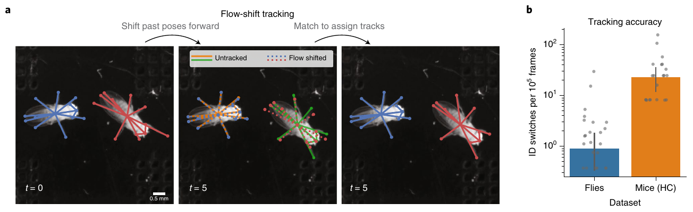
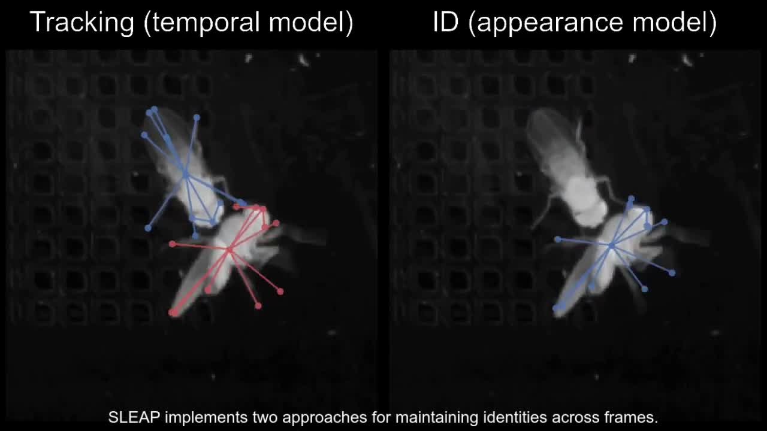
An identity error can persist after animals separate
Temporal tracking matches current poses to earlier poses using expected movement. SLEAP’s flow-shift method estimated how earlier body configurations moved into the new frame. That prediction made identity assignment possible without requiring every individual to have a distinctive visible mark.
When two animals cross, an incorrect assignment can propagate into subsequent frames. Later poses may be localized accurately while remaining attached to the wrong identity. The article’s tracking-comparison movie preserves this distinction between recovering a body configuration and assigning it to the correct individual.
An appearance-based identity model instead predicts an individual’s label from visible features. Because it can classify each frame independently, it can recover after a temporary switch when those features become informative again. Temporal continuity and appearance thus provide different forms of evidence for individual recognition.
Pereira et al. (2022), Fig. 5(a–b). Frame-to-frame identity matching and tracking errors.
Pereira et al. (2022), Supplementary Video 4. Temporal versus appearance identity tracking.
Pereira et al. (2022)
20
Notes:
• Temporal tracking matches current poses to earlier poses using expected movement. SLEAP’s flow-shift method estimated how earlier body configurations moved into the new frame. That prediction made identity assignment possible without requiring every individual to have a distinctive visible mark.
• When two animals cross, an incorrect assignment can propagate into subsequent frames. Later poses may be localized accurately while remaining attached to the wrong identity. The article’s tracking-comparison movie preserves this distinction between recovering a body configuration and assigning it to the correct individual.
• An appearance-based identity model instead predicts an individual’s label from visible features. Because it can classify each frame independently, it can recover after a temporary switch when those features become informative again. Temporal continuity and appearance thus provide different forms of evidence for individual recognition.
References:
Pereira TD, Tabris N, Matsliah A, Turner DM, Li J, Ravindranath S, Papadoyannis ES, Normand E, Deutsch DS, Wang ZY, McKenzie-Smith GC, Mitelut CC, Castro MD, D’Uva J, Kislin M, Sanes DH, Kocher SD, Wang SSH, Falkner AL, Shaevitz JW, Murthy M (2022). SLEAP: A deep learning system for multi-animal pose tracking. Nature Methods 19:486-495. https://doi.org/10.1038/s41592-022-01426-1
Figure: Pereira et al. (2022), Fig. 5(a–b). Frame-to-frame identity matching and tracking errors.
Figure source: https://doi.org/10.1038/s41592-022-01426-1
Article-provided recording:
Pereira et al. (2022), Supplementary Video 4. Temporal versus appearance identity tracking.
Article DOI: https://doi.org/10.1038/s41592-022-01426-1
Original media: https://media.springernature.com/original/springer-static/esm/art%3A10.1038%2Fs41592-022-01426-1/MediaObjects/41592_2022_1426_MOESM7_ESM.mp4
Original filename: 41592_2022_1426_MOESM7_ESM.mp4
Credit: Pereira et al. and the original study authors; Nature Methods
License: CC BY 4.0, original article supplementary material
H.264 at original dimensions, original timestamps and frame sequence; no crop, recoloring, overlays or speed change. Audio copied if present. Unedited source frame used as poster.
Click the recording in PowerPoint Slide Show for full-screen playback. The separate figure remains the credited static evidence. Embedded relationships and full media decoding were verified; PowerPoint GUI playback was unavailable. Google Slides imports can omit embedded videos: upload the separately supplied MP4 to Drive and insert it as a video. The PDF preview is static.

Slide 21
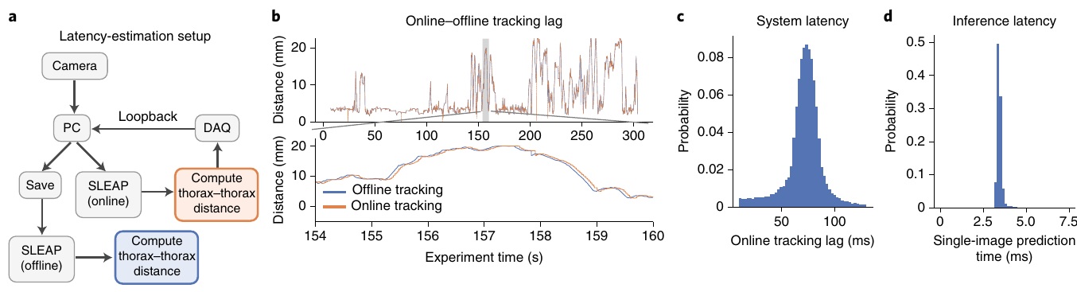
Measured delay differs from model inference speed
Pereira and colleagues timed a live tracking pipeline that measured distance between two flies and passed its output through a data-acquisition loop. The round-trip delay was approximately 71 milliseconds. Aligning the online measurement with the offline trace quantified how old the reported body configuration was when it became available to the controller.
The model’s single-image inference time was approximately 3.45 milliseconds in the tested configuration. The longer round-trip delay included other stages in acquisition, processing and communication. A model-speed benchmark therefore measured a component of the system rather than the entire sensor-to-action interval.
Comparing the online distance trace with the offline trace exposed the lag of the full pipeline. A trigger based on an earlier pose acts on animals that have continued moving. Delay calibration connected the timestamp of a tracked social configuration to the experimental event delivered in response, rather than treating model speed as the complete timing measurement.
Pereira et al. (2022), Fig. 6(a–d). Measured online tracking and inference latencies.
Pereira et al. (2022)
21
Notes:
• Pereira and colleagues timed a live tracking pipeline that measured distance between two flies and passed its output through a data-acquisition loop. The round-trip delay was approximately 71 milliseconds. Aligning the online measurement with the offline trace quantified how old the reported body configuration was when it became available to the controller.
• The model’s single-image inference time was approximately 3.45 milliseconds in the tested configuration. The longer round-trip delay included other stages in acquisition, processing and communication. A model-speed benchmark therefore measured a component of the system rather than the entire sensor-to-action interval.
• Comparing the online distance trace with the offline trace exposed the lag of the full pipeline. A trigger based on an earlier pose acts on animals that have continued moving. Delay calibration connected the timestamp of a tracked social configuration to the experimental event delivered in response, rather than treating model speed as the complete timing measurement.
References:
Pereira TD, Tabris N, Matsliah A, Turner DM, Li J, Ravindranath S, Papadoyannis ES, Normand E, Deutsch DS, Wang ZY, McKenzie-Smith GC, Mitelut CC, Castro MD, D’Uva J, Kislin M, Sanes DH, Kocher SD, Wang SSH, Falkner AL, Shaevitz JW, Murthy M (2022). SLEAP: A deep learning system for multi-animal pose tracking. Nature Methods 19:486-495. https://doi.org/10.1038/s41592-022-01426-1
Figure: Pereira et al. (2022), Fig. 6(a–d). Measured online tracking and inference latencies.
Figure source: https://doi.org/10.1038/s41592-022-01426-1

Slide 22
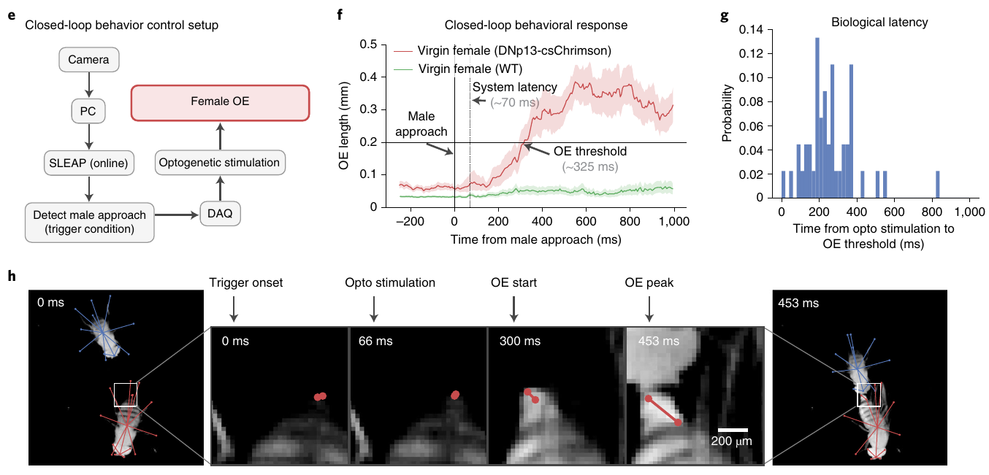
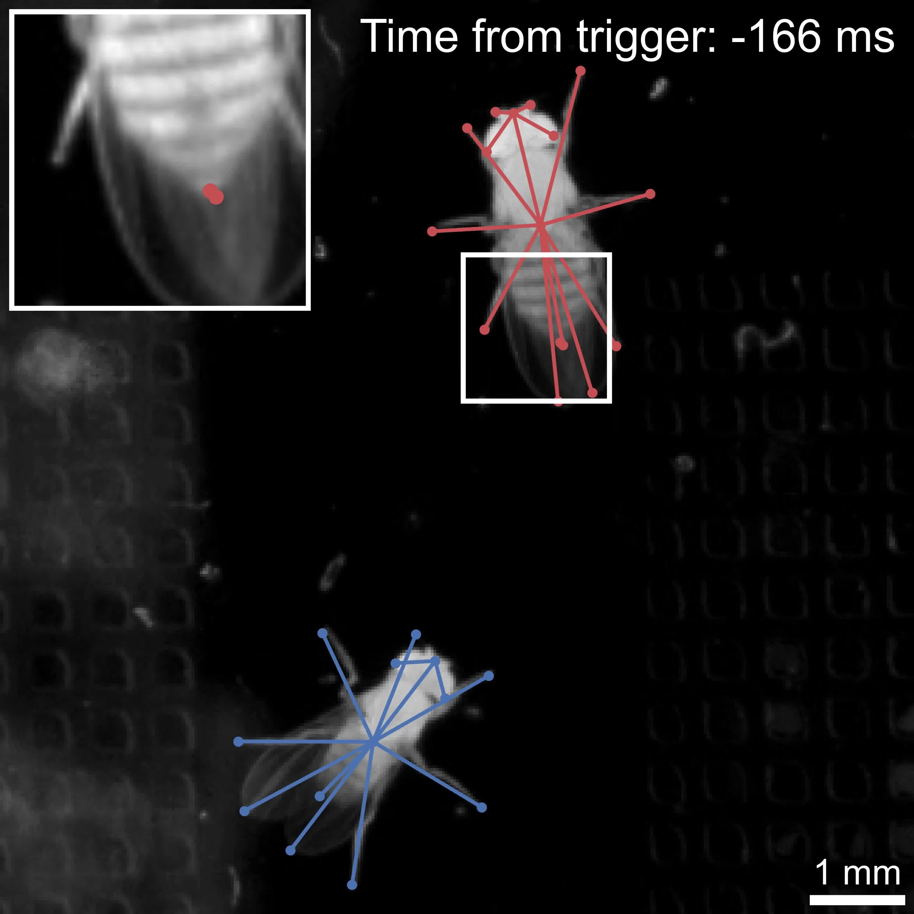
Social geometry specifies an intervention trigger
SLEAP detected a male fly approaching a female from behind using their relative positions and orientations. That pose-defined event triggered red light in an optogenetic experiment, which uses a genetically expressed light-sensitive protein to change neuronal activity. The trigger depended on social geometry rather than merely detecting two nearby flies.
The light-sensitive protein csChrimson is a cation channel, a membrane protein that passes positively charged ions. Light opens the channel in targeted cells, changing their electrical activity. In the tested females, activation elicited extrusion of the ovipositor, the terminal egg-laying structure, while comparison females lacking the experimental channel did not acquire the same triggered response.
The social-control system contributed about 77 milliseconds of delay, and the behavioral response followed light onset after about 249 milliseconds. Their combined delay was about 326 milliseconds. The observed response therefore reflected both electronic processing and the animal’s own time to produce the movement.
Pereira et al. (2022), Fig. 6(e–h). Approach-triggered light and female ovipositor extrusion.
Pereira et al. (2022), Supplementary Video 5. Approach-triggered ovipositor extrusion.
Pereira et al. (2022)
22
Notes:
• SLEAP detected a male fly approaching a female from behind using their relative positions and orientations. That pose-defined event triggered red light in an optogenetic experiment, which uses a genetically expressed light-sensitive protein to change neuronal activity. The trigger depended on social geometry rather than merely detecting two nearby flies.
• The light-sensitive protein csChrimson is a cation channel, a membrane protein that passes positively charged ions. Light opens the channel in targeted cells, changing their electrical activity. In the tested females, activation elicited extrusion of the ovipositor, the terminal egg-laying structure, while comparison females lacking the experimental channel did not acquire the same triggered response.
• The social-control system contributed about 77 milliseconds of delay, and the behavioral response followed light onset after about 249 milliseconds. Their combined delay was about 326 milliseconds. The observed response therefore reflected both electronic processing and the animal’s own time to produce the movement.
References:
Pereira TD, Tabris N, Matsliah A, Turner DM, Li J, Ravindranath S, Papadoyannis ES, Normand E, Deutsch DS, Wang ZY, McKenzie-Smith GC, Mitelut CC, Castro MD, D’Uva J, Kislin M, Sanes DH, Kocher SD, Wang SSH, Falkner AL, Shaevitz JW, Murthy M (2022). SLEAP: A deep learning system for multi-animal pose tracking. Nature Methods 19:486-495. https://doi.org/10.1038/s41592-022-01426-1
Figure: Pereira et al. (2022), Fig. 6(e–h). Approach-triggered light and female ovipositor extrusion.
Figure source: https://doi.org/10.1038/s41592-022-01426-1
Article-provided recording:
Pereira et al. (2022), Supplementary Video 5. Approach-triggered ovipositor extrusion.
Article DOI: https://doi.org/10.1038/s41592-022-01426-1
Original media: https://media.springernature.com/original/springer-static/esm/art%3A10.1038%2Fs41592-022-01426-1/MediaObjects/41592_2022_1426_MOESM8_ESM.mp4
Original filename: 41592_2022_1426_MOESM8_ESM.mp4
Credit: Pereira et al. and the original study authors; Nature Methods
License: CC BY 4.0, original article supplementary material
H.264 at original dimensions, original timestamps and frame sequence; no crop, recoloring, overlays or speed change. Audio copied if present. Unedited source frame used as poster.
Click the recording in PowerPoint Slide Show for full-screen playback. The separate figure remains the credited static evidence. Embedded relationships and full media decoding were verified; PowerPoint GUI playback was unavailable. Google Slides imports can omit embedded videos: upload the separately supplied MP4 to Drive and insert it as a video. The PDF preview is static.

Slide 23
Error distributions locate difficult anatomical landmarks
SLEAP evaluated predicted landmarks against manual locations in held-out frames. A localization error is the distance between those positions in the image. Measuring errors for individual body parts exposed differences that a single average accuracy could conceal.
Visible appendages, overlapping limbs and changes in body orientation created different recognition demands. The distributions included both small common deviations and less frequent larger mistakes. Reporting an upper portion of the error distribution described difficult frames as well as typical performance.
The study also expressed errors relative to body size, linking pixels to the animal being recorded. A distance in image coordinates acquires behavioral significance through anatomical scale. Part-specific evaluation connected the tracker’s output to the precision needed for posture or contact measurements.
Pereira et al. (2022), Fig. 2(a–g). Body-part localization errors and manually annotated landmarks.
Pereira et al. (2022)
23
Notes:
• SLEAP evaluated predicted landmarks against manual locations in held-out frames. A localization error is the distance between those positions in the image. Measuring errors for individual body parts exposed differences that a single average accuracy could conceal.
• Visible appendages, overlapping limbs and changes in body orientation created different recognition demands. The distributions included both small common deviations and less frequent larger mistakes. Reporting an upper portion of the error distribution described difficult frames as well as typical performance.
• The study also expressed errors relative to body size, linking pixels to the animal being recorded. A distance in image coordinates acquires behavioral significance through anatomical scale. Part-specific evaluation connected the tracker’s output to the precision needed for posture or contact measurements.
References:
Pereira TD, Tabris N, Matsliah A, Turner DM, Li J, Ravindranath S, Papadoyannis ES, Normand E, Deutsch DS, Wang ZY, McKenzie-Smith GC, Mitelut CC, Castro MD, D’Uva J, Kislin M, Sanes DH, Kocher SD, Wang SSH, Falkner AL, Shaevitz JW, Murthy M (2022). SLEAP: A deep learning system for multi-animal pose tracking. Nature Methods 19:486-495. https://doi.org/10.1038/s41592-022-01426-1
Figure: Pereira et al. (2022), Fig. 2(a–g). Body-part localization errors and manually annotated landmarks.
Figure source: https://doi.org/10.1038/s41592-022-01426-1

Slide 24
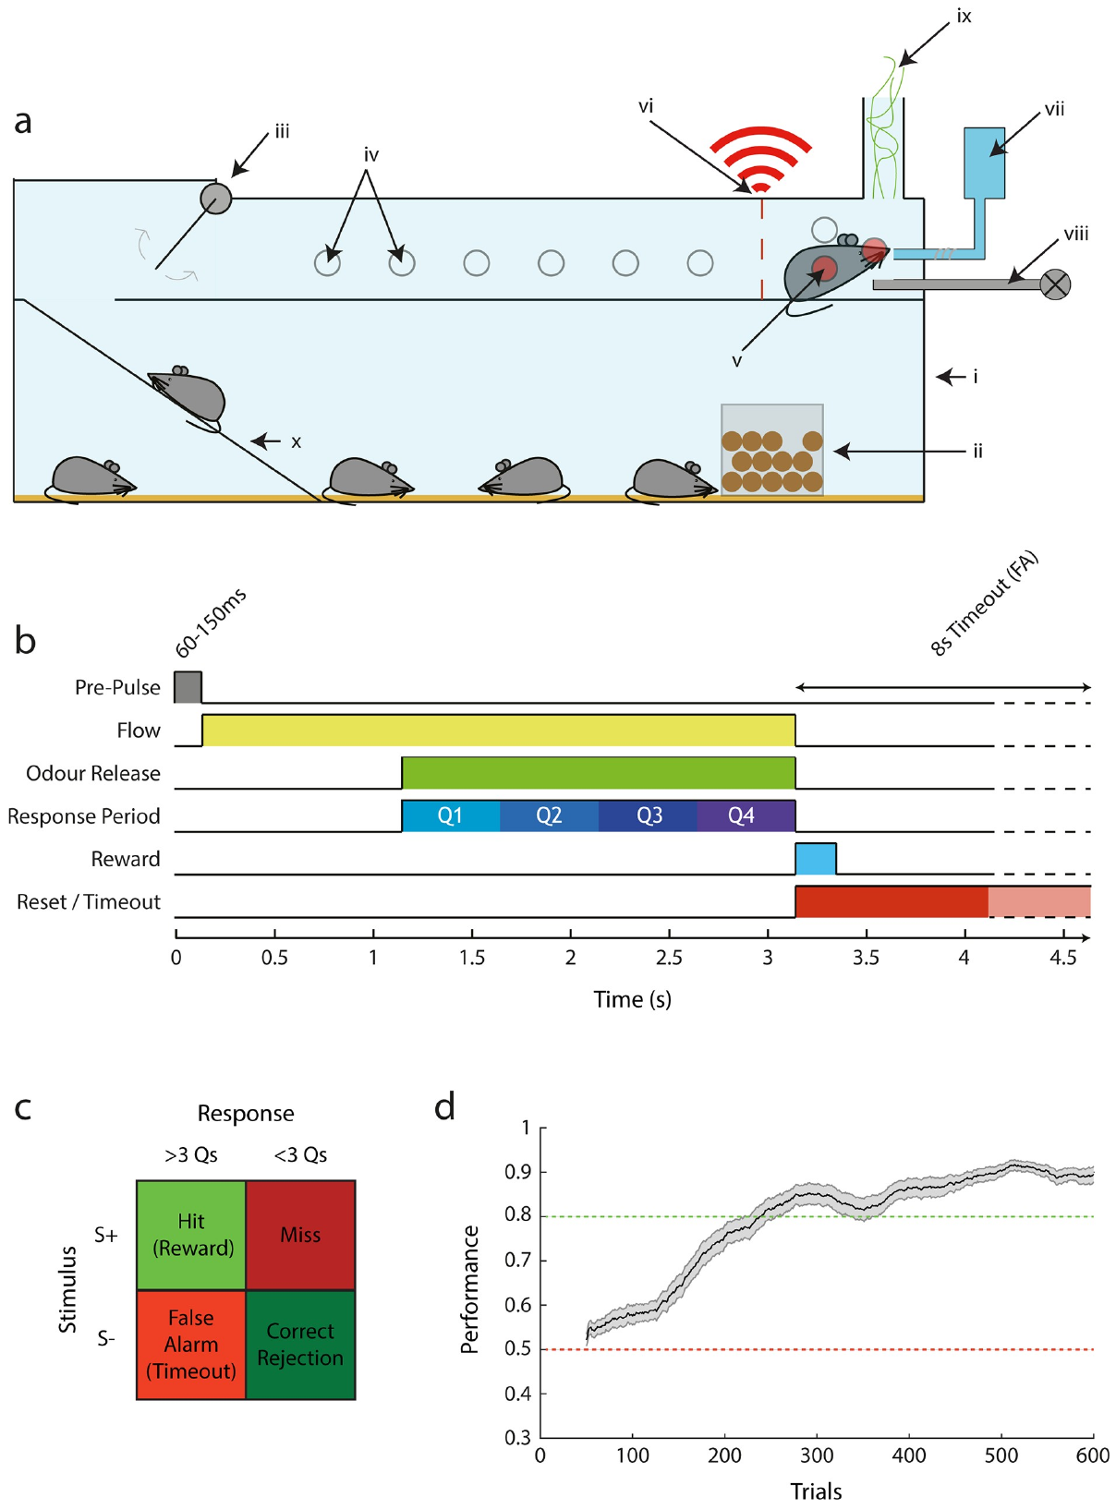
Mice can initiate tasks from a shared home cage
Erskine and colleagues built AutonoMouse, an automated operant system connected to a shared home cage. Mice could enter an upper task chamber at times they selected. Food remained available in the common cage, and the task supplied water rewards during successful trials.
Radio-frequency identification, or RFID, read each animal’s implanted transponder when it entered the chamber. The computer then selected that individual’s task and recorded its responses. Individual recognition allowed animals with different learning histories to share the apparatus without receiving identical trial sequences.
The system reduced the need to remove an animal from its social housing for every session. Its door and infrared sensors controlled access to the task area, while the animal controlled when it approached. Self-initiated entry made participation measurable as part of behavior rather than fixing every session to an experimenter’s schedule.
Erskine et al. (2019), Fig. 1(a–d). Home-cage access and the behavioral task.
Erskine et al. (2019)
24
Notes:
• Erskine and colleagues built AutonoMouse, an automated operant system connected to a shared home cage. Mice could enter an upper task chamber at times they selected. Food remained available in the common cage, and the task supplied water rewards during successful trials.
• Radio-frequency identification, or RFID, read each animal’s implanted transponder when it entered the chamber. The computer then selected that individual’s task and recorded its responses. Individual recognition allowed animals with different learning histories to share the apparatus without receiving identical trial sequences.
• The system reduced the need to remove an animal from its social housing for every session. Its door and infrared sensors controlled access to the task area, while the animal controlled when it approached. Self-initiated entry made participation measurable as part of behavior rather than fixing every session to an experimenter’s schedule.
References:
Erskine A, Bus T, Herb JT, Schaefer AT (2019). AutonoMouse: High throughput operant conditioning reveals progressive impairment with graded olfactory bulb lesions. PLOS ONE 14:e0211571. https://doi.org/10.1371/journal.pone.0211571
Figure: Erskine et al. (2019), Fig. 1(a–d). Home-cage access and the behavioral task.
Figure source: https://doi.org/10.1371/journal.pone.0211571

Slide 25
A go/no-go task links odor choices to water
An operant task makes an outcome depend on an animal’s action. In AutonoMouse, entry and a nose-position sensor initiated odor presentation. A go/no-go discrimination paired one odor with a licking response and another with withholding that response.
The computer divided the response period into quarters and assessed licking across them. Licking during enough of the response period to the rewarded odor produced water. Withholding licking to the other odor counted as a correct rejection, distinguishing stimulus discrimination from indiscriminate responding.
Automated trial records linked stimulus identity, response timing and reward delivery for each mouse. Learning involved acquiring the appropriate response rule as well as recognizing the odor pair. A task’s contingency, the action-to-outcome relationship, therefore formed part of what the animal learned.
Erskine et al. (2019), Fig. 1(a–d). Trial timing, responses and reward rules.
Erskine et al. (2019)
25
Notes:
• An operant task makes an outcome depend on an animal’s action. In AutonoMouse, entry and a nose-position sensor initiated odor presentation. A go/no-go discrimination paired one odor with a licking response and another with withholding that response.
• The computer divided the response period into quarters and assessed licking across them. Licking during enough of the response period to the rewarded odor produced water. Withholding licking to the other odor counted as a correct rejection, distinguishing stimulus discrimination from indiscriminate responding.
• Automated trial records linked stimulus identity, response timing and reward delivery for each mouse. Learning involved acquiring the appropriate response rule as well as recognizing the odor pair. A task’s contingency, the action-to-outcome relationship, therefore formed part of what the animal learned.
References:
Erskine A, Bus T, Herb JT, Schaefer AT (2019). AutonoMouse: High throughput operant conditioning reveals progressive impairment with graded olfactory bulb lesions. PLOS ONE 14:e0211571. https://doi.org/10.1371/journal.pone.0211571
Figure: Erskine et al. (2019), Fig. 1(a–d). Trial timing, responses and reward rules.
Figure source: https://doi.org/10.1371/journal.pone.0211571

Slide 26
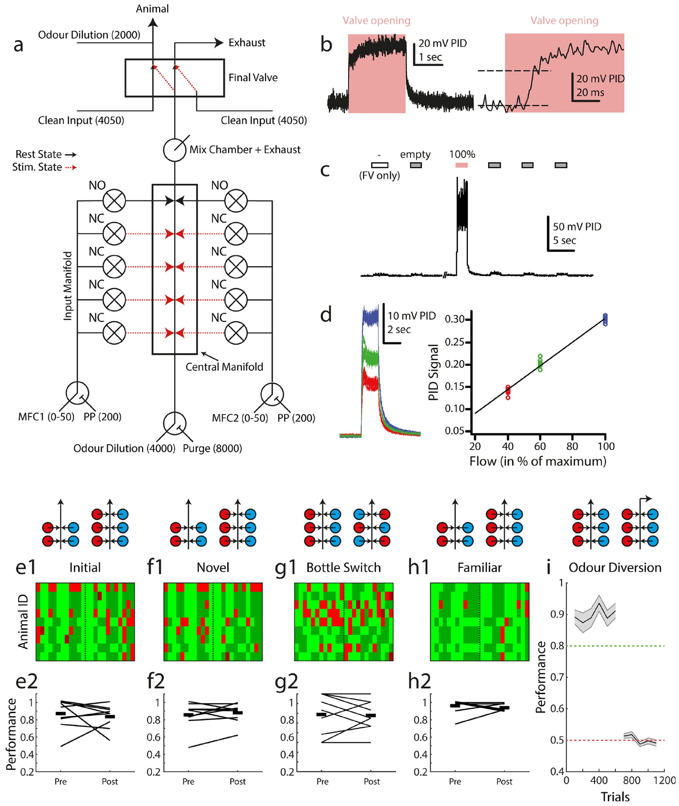
The delivered stimulus must match the programmed odor
An olfactometer controls the delivery of odorized air. AutonoMouse combined odor sources, regulated airflow and valves to supply the intended stimulus at the nose port. The authors measured the delivered odor signal with a detector rather than assuming that a software command immediately produced the requested concentration.
Valve sounds, source position or residual odor could provide unintended cues to reward. The study changed valve assignments and bottle arrangements, then assessed whether mice retained discrimination. Diverting the odor stream away from the animal disrupted performance even though the apparatus still operated.
Changing airflow dilution produced measurable differences in the odor pulse. Calibration tied the programmed stimulus to the signal reaching the animal. The control experiments connected correct choices to odor availability rather than to a predictable mechanical event elsewhere in the device.
Erskine et al. (2019), Fig. 3(a–i). Odor delivery calibration and cue-control experiments.
Erskine et al. (2019)
26
Notes:
• An olfactometer controls the delivery of odorized air. AutonoMouse combined odor sources, regulated airflow and valves to supply the intended stimulus at the nose port. The authors measured the delivered odor signal with a detector rather than assuming that a software command immediately produced the requested concentration.
• Valve sounds, source position or residual odor could provide unintended cues to reward. The study changed valve assignments and bottle arrangements, then assessed whether mice retained discrimination. Diverting the odor stream away from the animal disrupted performance even though the apparatus still operated.
• Changing airflow dilution produced measurable differences in the odor pulse. Calibration tied the programmed stimulus to the signal reaching the animal. The control experiments connected correct choices to odor availability rather than to a predictable mechanical event elsewhere in the device.
References:
Erskine A, Bus T, Herb JT, Schaefer AT (2019). AutonoMouse: High throughput operant conditioning reveals progressive impairment with graded olfactory bulb lesions. PLOS ONE 14:e0211571. https://doi.org/10.1371/journal.pone.0211571
Figure: Erskine et al. (2019), Fig. 3(a–i). Odor delivery calibration and cue-control experiments.
Figure source: https://doi.org/10.1371/journal.pone.0211571

Slide 27
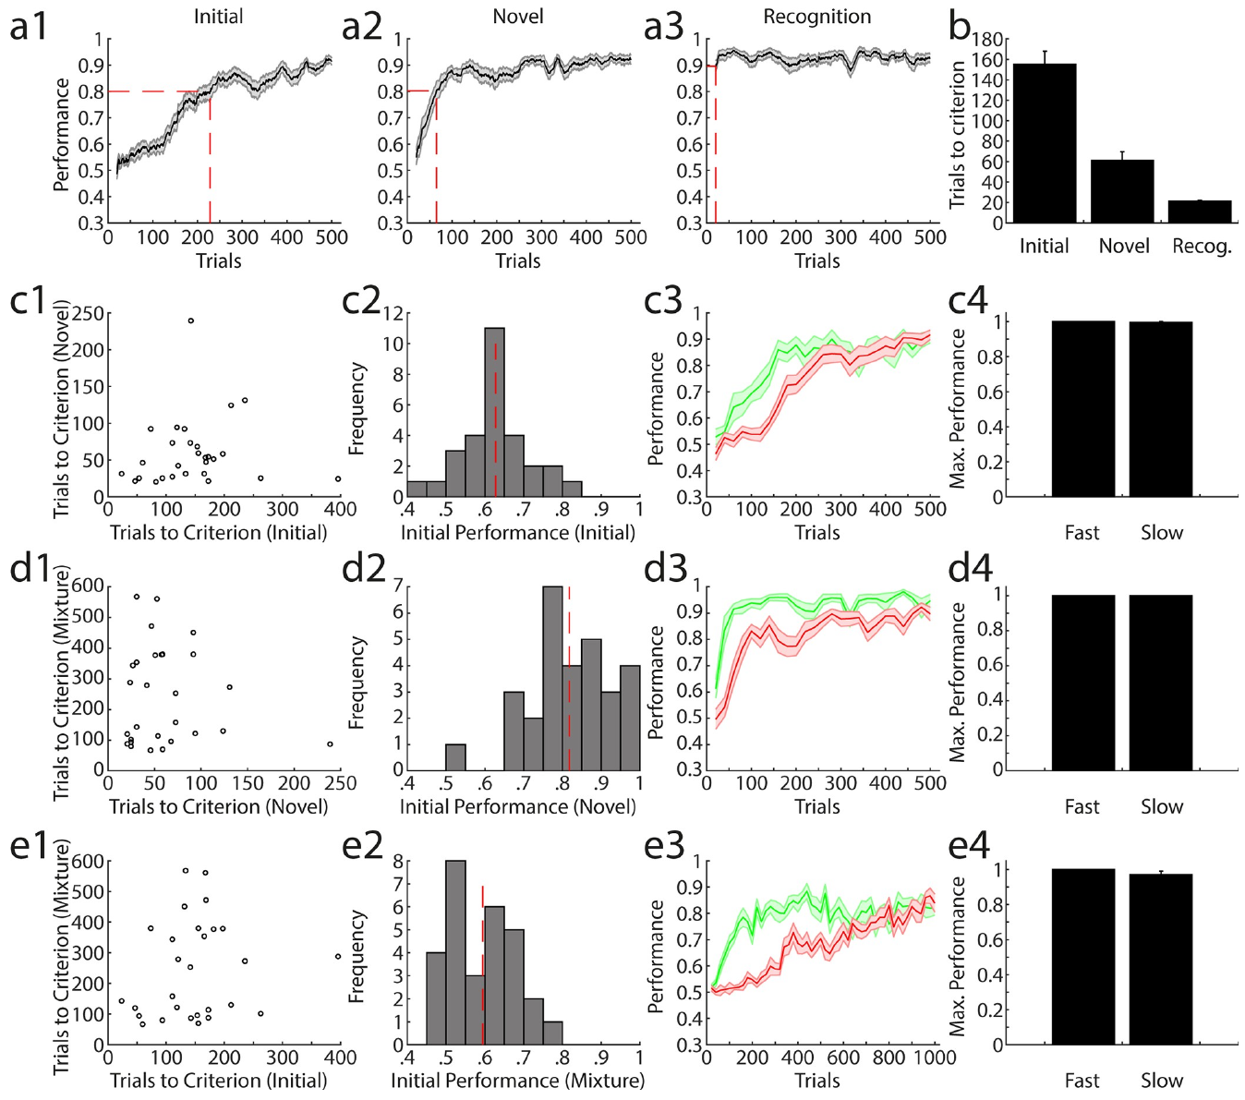
Task experience accelerates learning of new odor pairs
Mice first had to learn both an odor discrimination and the task’s response rules. After acquiring that initial task, they learned a new odor pair more rapidly. The same licking-and-reward structure remained in place while the sensory identities changed.
Performance on a familiar odor pair recovered quickly because the animals had already learned which stimulus required which action. Transfer of task experience differs from remembering a particular odor association: the former supports acquisition with new stimuli, while the latter preserves an already learned choice.
The study compared initial, novel and familiar discrimination within the same automated system. Their different learning trajectories separated sensory novelty from familiarity with the action requirements. Reusing an interface can therefore change acquisition speed even when the new sensory distinction remains to be learned.
Erskine et al. (2019), Fig. 4(a–e). Initial, novel, familiar and mixture discrimination.
Erskine et al. (2019)
27
Notes:
• Mice first had to learn both an odor discrimination and the task’s response rules. After acquiring that initial task, they learned a new odor pair more rapidly. The same licking-and-reward structure remained in place while the sensory identities changed.
• Performance on a familiar odor pair recovered quickly because the animals had already learned which stimulus required which action. Transfer of task experience differs from remembering a particular odor association: the former supports acquisition with new stimuli, while the latter preserves an already learned choice.
• The study compared initial, novel and familiar discrimination within the same automated system. Their different learning trajectories separated sensory novelty from familiarity with the action requirements. Reusing an interface can therefore change acquisition speed even when the new sensory distinction remains to be learned.
References:
Erskine A, Bus T, Herb JT, Schaefer AT (2019). AutonoMouse: High throughput operant conditioning reveals progressive impairment with graded olfactory bulb lesions. PLOS ONE 14:e0211571. https://doi.org/10.1371/journal.pone.0211571
Figure: Erskine et al. (2019), Fig. 4(a–e). Initial, novel, familiar and mixture discrimination.
Figure source: https://doi.org/10.1371/journal.pone.0211571

Slide 28
Early learning speed does not fix eventual performance
AutonoMouse recorded enough trials to follow animals through early acquisition and later performance. Mice classified as slow early learners initially chose less accurately than faster learners. Continued training brought the groups to comparable maximum discrimination performance.
The task also changed difficulty by presenting mixtures containing the same two odorants in different proportions. A 60:40 mixture and its 40:60 counterpart shared both components, requiring discrimination of their relative contributions rather than recognition of completely different substances.
Learning speed varied across the initial, novel and mixture tasks. An animal’s performance depended on the particular sensory problem and its training history. Longitudinal measurement separated a temporarily difficult acquisition period from the level of discrimination the animal eventually achieved.
Erskine et al. (2019), Fig. 4(c–e). Learning trajectories and final discrimination levels.
Erskine et al. (2019)
28
Notes:
• AutonoMouse recorded enough trials to follow animals through early acquisition and later performance. Mice classified as slow early learners initially chose less accurately than faster learners. Continued training brought the groups to comparable maximum discrimination performance.
• The task also changed difficulty by presenting mixtures containing the same two odorants in different proportions. A 60:40 mixture and its 40:60 counterpart shared both components, requiring discrimination of their relative contributions rather than recognition of completely different substances.
• Learning speed varied across the initial, novel and mixture tasks. An animal’s performance depended on the particular sensory problem and its training history. Longitudinal measurement separated a temporarily difficult acquisition period from the level of discrimination the animal eventually achieved.
References:
Erskine A, Bus T, Herb JT, Schaefer AT (2019). AutonoMouse: High throughput operant conditioning reveals progressive impairment with graded olfactory bulb lesions. PLOS ONE 14:e0211571. https://doi.org/10.1371/journal.pone.0211571
Figure: Erskine et al. (2019), Fig. 4(c–e). Learning trajectories and final discrimination levels.
Figure source: https://doi.org/10.1371/journal.pone.0211571

Slide 29
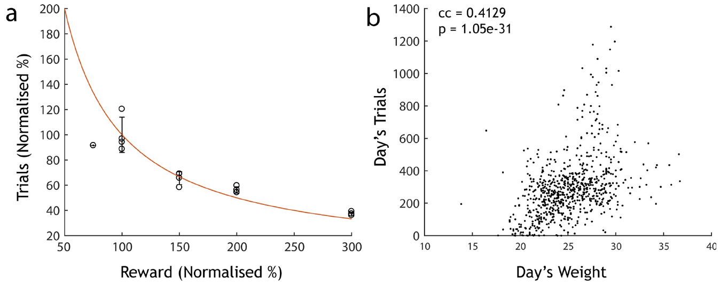
Reward size changes self-selected participation
AutonoMouse supplied daily water through successful task participation without imposing a separate water-restriction schedule. The authors varied the volume delivered on each correct trial. At the baseline reward of 12 microliters, mice performed repeated self-initiated trials throughout their active periods.
Larger water rewards reduced the number of trials animals chose to perform. Their behavior approximately maintained daily water acquisition by changing participation. Motivation was therefore expressed through the relation between physiological demand, reward magnitude and the number of actions performed.
Reducing rewards substantially below 12 microliters did not produce enough extra trials to fully compensate. Voluntary entry consequently differed from unlimited willingness to work for smaller rewards. The measured reward-response relation supplied a concrete constraint on designing self-paced tasks that also provide essential resources.
Erskine et al. (2019), Fig. 5(a–b). Water reward size, trial numbers and body weight.
Erskine et al. (2019)
29
Notes:
• AutonoMouse supplied daily water through successful task participation without imposing a separate water-restriction schedule. The authors varied the volume delivered on each correct trial. At the baseline reward of 12 microliters, mice performed repeated self-initiated trials throughout their active periods.
• Larger water rewards reduced the number of trials animals chose to perform. Their behavior approximately maintained daily water acquisition by changing participation. Motivation was therefore expressed through the relation between physiological demand, reward magnitude and the number of actions performed.
• Reducing rewards substantially below 12 microliters did not produce enough extra trials to fully compensate. Voluntary entry consequently differed from unlimited willingness to work for smaller rewards. The measured reward-response relation supplied a concrete constraint on designing self-paced tasks that also provide essential resources.
References:
Erskine A, Bus T, Herb JT, Schaefer AT (2019). AutonoMouse: High throughput operant conditioning reveals progressive impairment with graded olfactory bulb lesions. PLOS ONE 14:e0211571. https://doi.org/10.1371/journal.pone.0211571
Figure: Erskine et al. (2019), Fig. 5(a–b). Water reward size, trial numbers and body weight.
Figure source: https://doi.org/10.1371/journal.pone.0211571

Slide 30
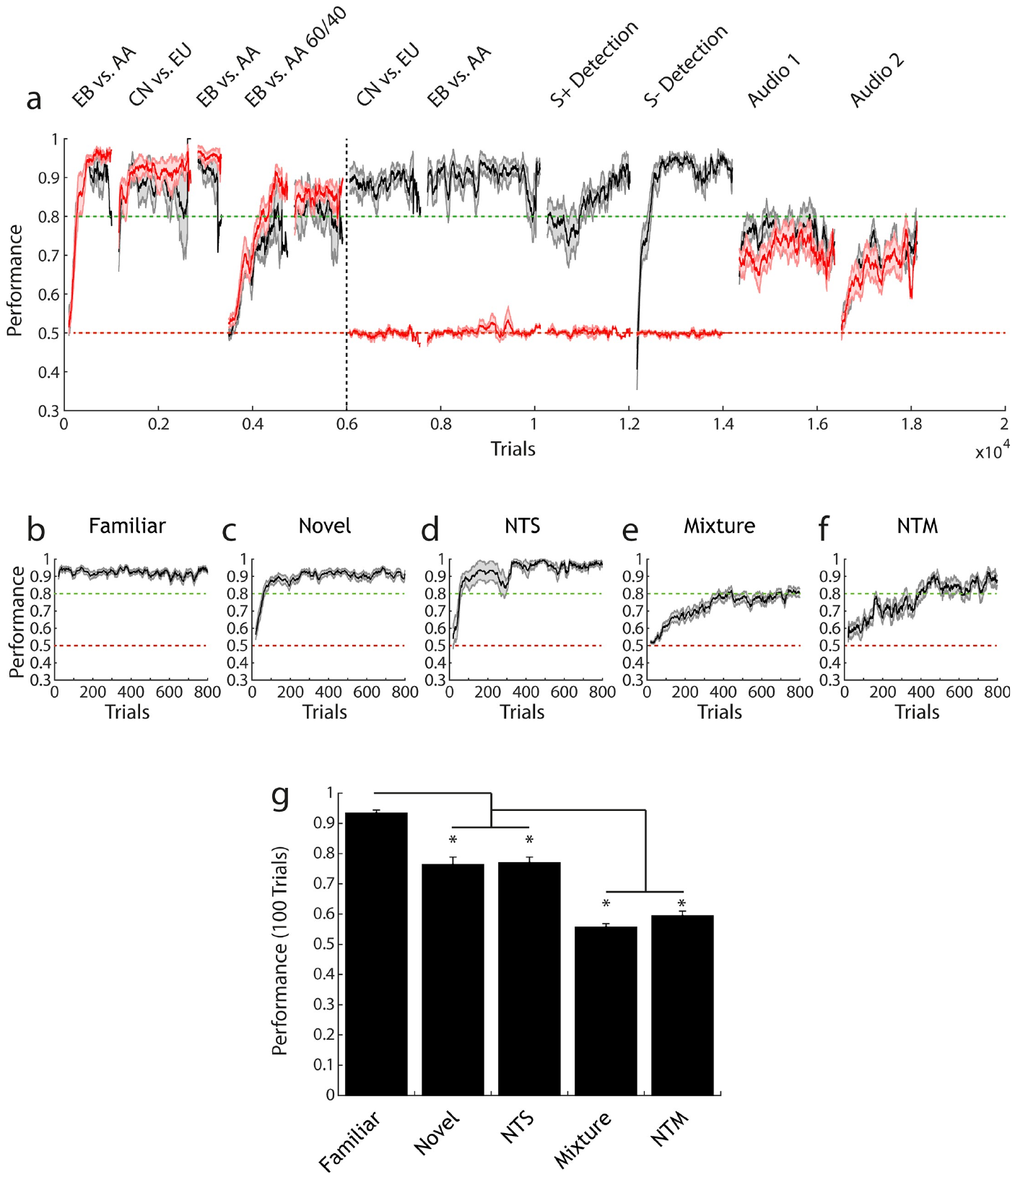
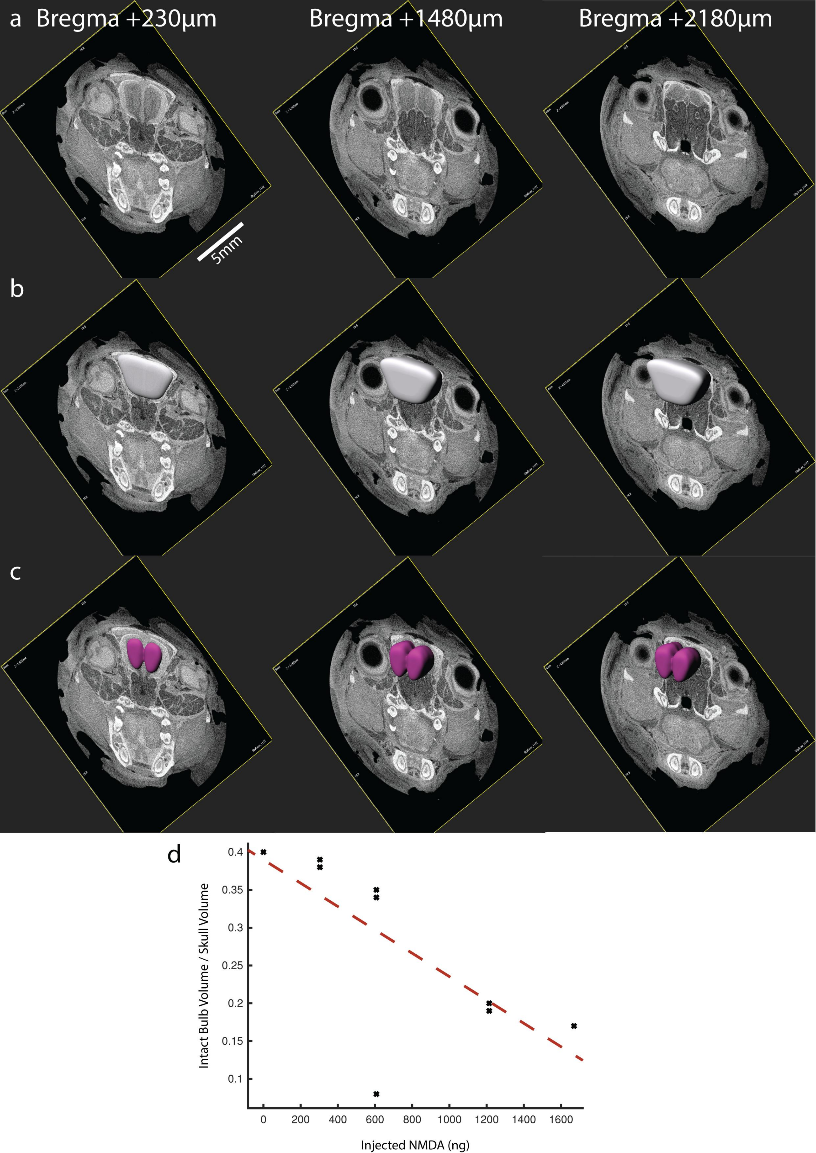
Bulb injury separates sensory loss from task failure
The olfactory bulbs are forebrain structures required for the odor tasks tested in AutonoMouse. Erskine and colleagues produced graded excitotoxic lesions, damage caused by excessive activation, and measured the remaining bulb tissue using micro-computed tomography. Published anatomical sections localized the tissue affected by the intervention.
Extensive bilateral lesions abolished accurate odor detection and discrimination. Sham-treated mice retained the learned discriminations and acquired new ones. The affected animals still performed auditory discrimination tasks using the same general response apparatus, linking the deficit to the sensory modality rather than a loss of all task performance.
The anatomy and behavior were measured together. Bulb volume was normalized to skull volume to compare injury across animals of different sizes. The preserved auditory behavior provided a positive control for responding, learning and obtaining rewards after the olfactory intervention.
Erskine et al. (2019), Fig. 6(a–g). Odor discrimination before and after large lesions.
Erskine et al. (2019), Supplementary Fig. S4(a–d). Original CT sections and olfactory-bulb volume measurements.
Erskine et al. (2019)
30
Notes:
• The olfactory bulbs are forebrain structures required for the odor tasks tested in AutonoMouse. Erskine and colleagues produced graded excitotoxic lesions, damage caused by excessive activation, and measured the remaining bulb tissue using micro-computed tomography. Published anatomical sections localized the tissue affected by the intervention.
• Extensive bilateral lesions abolished accurate odor detection and discrimination. Sham-treated mice retained the learned discriminations and acquired new ones. The affected animals still performed auditory discrimination tasks using the same general response apparatus, linking the deficit to the sensory modality rather than a loss of all task performance.
• The anatomy and behavior were measured together. Bulb volume was normalized to skull volume to compare injury across animals of different sizes. The preserved auditory behavior provided a positive control for responding, learning and obtaining rewards after the olfactory intervention.
References:
Erskine A, Bus T, Herb JT, Schaefer AT (2019). AutonoMouse: High throughput operant conditioning reveals progressive impairment with graded olfactory bulb lesions. PLOS ONE 14:e0211571. https://doi.org/10.1371/journal.pone.0211571
Figure: Erskine et al. (2019), Fig. 6(a–g). Odor discrimination before and after large lesions.
Figure source: https://doi.org/10.1371/journal.pone.0211571
Figure: Erskine et al. (2019), Supplementary Fig. S4(a–d). Original CT sections and olfactory-bulb volume measurements.
Figure source: https://doi.org/10.1371/journal.pone.0211571

Slide 31
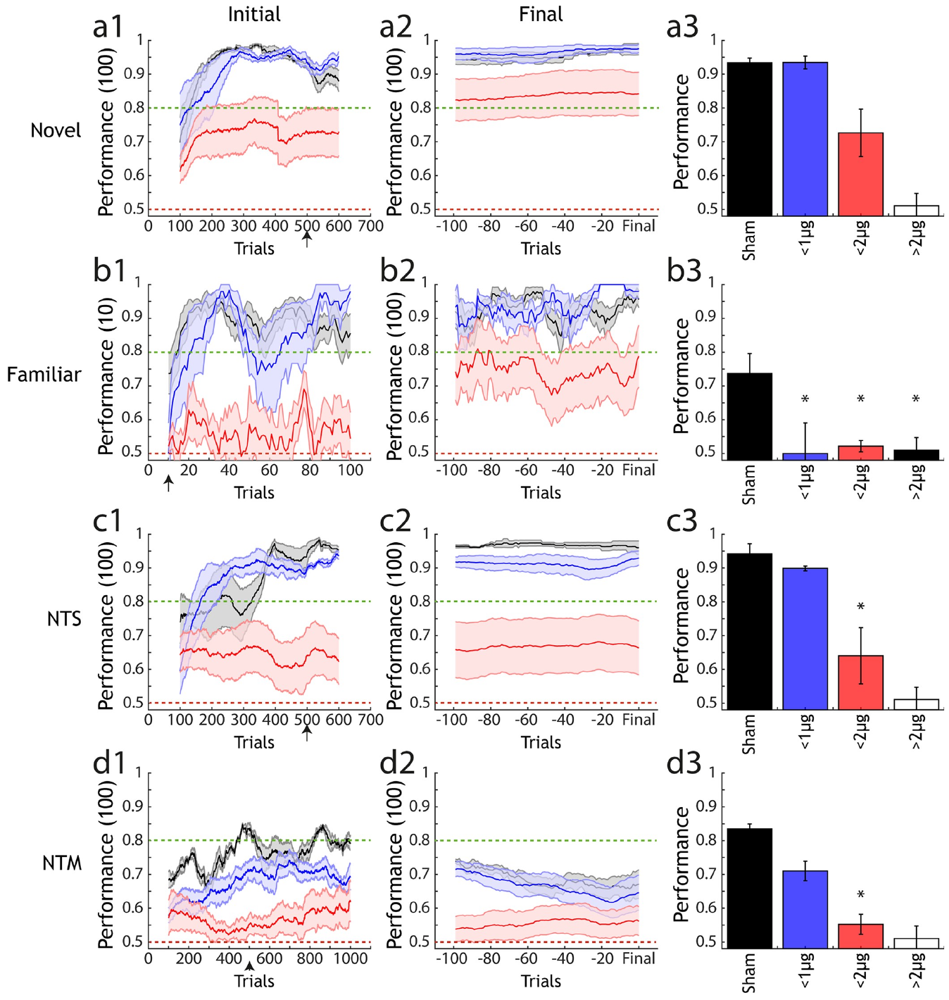
More demanding odor tasks expose partial impairment
Partial olfactory-bulb damage affected odor tasks differently from extensive lesions. Mice with smaller lesions could still learn simple novel odor pairs. More demanding mixture discriminations exposed deficits that were less evident when the two stimuli were chemically distinct.
The study compared familiar discrimination, acquisition with novel odors and discrimination of overlapping mixtures. These conditions varied the sensory information and learning demand while retaining the same general licking response. Familiar associations and new discrimination problems therefore placed different requirements on the remaining olfactory tissue.
Task difficulty changed the sensitivity of the behavioral assay to injury. A simple successful choice could coexist with impairment on a more demanding distinction. Anatomical volume measurements and multiple task conditions connected the extent of bulb disruption to the particular behavior being assessed.
Erskine et al. (2019), Fig. 7(a–d). Discrimination following graded olfactory-bulb lesions.
Erskine et al. (2019), Supplementary Fig. S4(a–d). CT localization and measurement of intact olfactory-bulb tissue.
Erskine et al. (2019)
31
Notes:
• Partial olfactory-bulb damage affected odor tasks differently from extensive lesions. Mice with smaller lesions could still learn simple novel odor pairs. More demanding mixture discriminations exposed deficits that were less evident when the two stimuli were chemically distinct.
• The study compared familiar discrimination, acquisition with novel odors and discrimination of overlapping mixtures. These conditions varied the sensory information and learning demand while retaining the same general licking response. Familiar associations and new discrimination problems therefore placed different requirements on the remaining olfactory tissue.
• Task difficulty changed the sensitivity of the behavioral assay to injury. A simple successful choice could coexist with impairment on a more demanding distinction. Anatomical volume measurements and multiple task conditions connected the extent of bulb disruption to the particular behavior being assessed.
References:
Erskine A, Bus T, Herb JT, Schaefer AT (2019). AutonoMouse: High throughput operant conditioning reveals progressive impairment with graded olfactory bulb lesions. PLOS ONE 14:e0211571. https://doi.org/10.1371/journal.pone.0211571
Figure: Erskine et al. (2019), Fig. 7(a–d). Discrimination following graded olfactory-bulb lesions.
Figure source: https://doi.org/10.1371/journal.pone.0211571
Figure: Erskine et al. (2019), Supplementary Fig. S4(a–d). CT localization and measurement of intact olfactory-bulb tissue.
Figure source: https://doi.org/10.1371/journal.pone.0211571

Slide 32
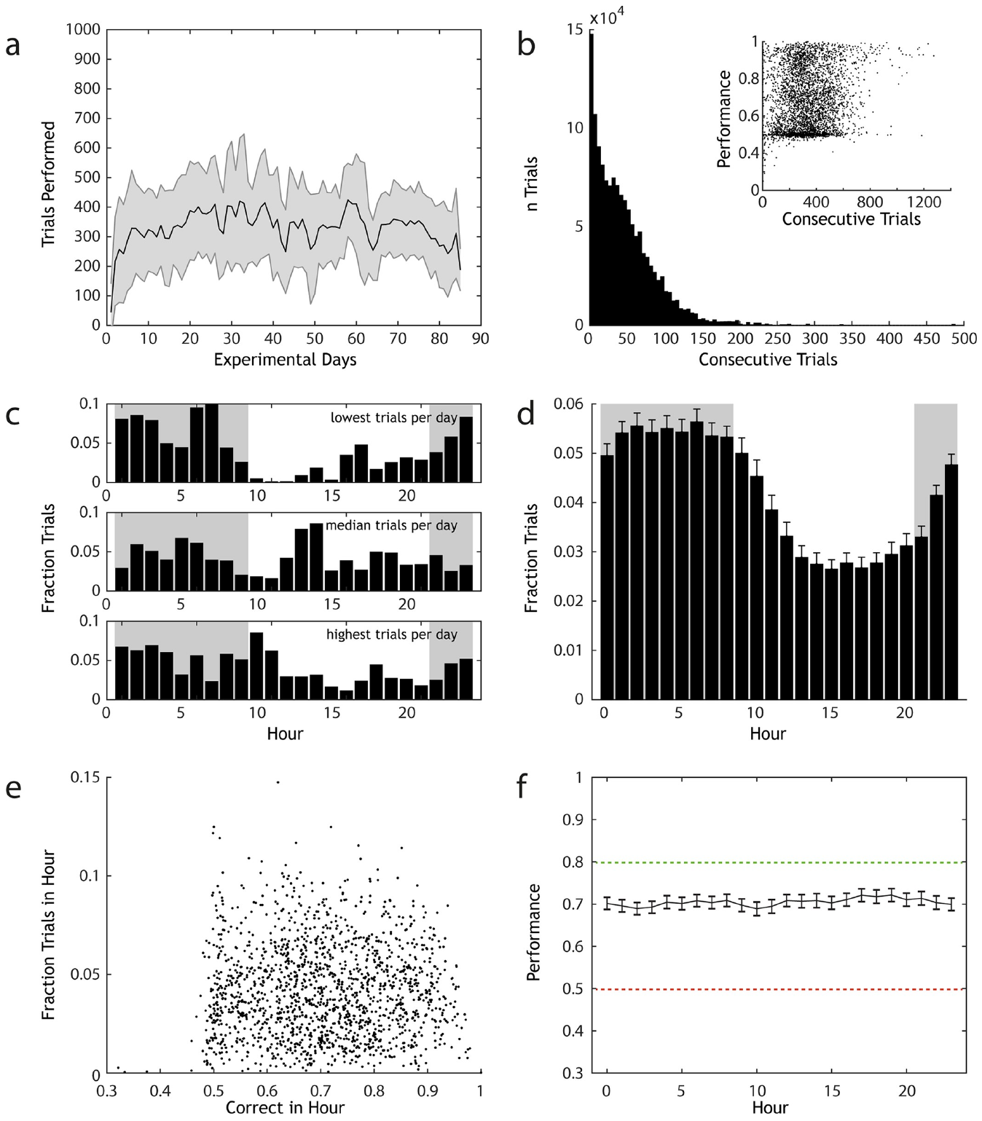
Participation timing separates activity from accuracy
AutonoMouse logged when each individually identified mouse entered the task and completed trials. Animals performed more trials during their dark-phase activity period. Continuous monitoring captured these self-selected schedules instead of restricting observation to a fixed daytime session.
Trial frequency and discrimination accuracy were measured separately across the daily cycle. More participation at a particular hour did not translate into a matching systematic rise in accuracy. The amount of recorded behavior and the quality of stimulus discrimination therefore described different features of the animal’s activity.
Animals often performed runs of consecutive trials, then returned to the shared cage. Linking those bouts to individual identity preserved differences in participation schedules. Automated longitudinal records connected access, activity and task performance without equating frequent participation with better discrimination.
Erskine et al. (2019), Fig. 2(a–f). Self-initiated trials and discrimination across the daily cycle.
Erskine et al. (2019)
32
Notes:
• AutonoMouse logged when each individually identified mouse entered the task and completed trials. Animals performed more trials during their dark-phase activity period. Continuous monitoring captured these self-selected schedules instead of restricting observation to a fixed daytime session.
• Trial frequency and discrimination accuracy were measured separately across the daily cycle. More participation at a particular hour did not translate into a matching systematic rise in accuracy. The amount of recorded behavior and the quality of stimulus discrimination therefore described different features of the animal’s activity.
• Animals often performed runs of consecutive trials, then returned to the shared cage. Linking those bouts to individual identity preserved differences in participation schedules. Automated longitudinal records connected access, activity and task performance without equating frequent participation with better discrimination.
References:
Erskine A, Bus T, Herb JT, Schaefer AT (2019). AutonoMouse: High throughput operant conditioning reveals progressive impairment with graded olfactory bulb lesions. PLOS ONE 14:e0211571. https://doi.org/10.1371/journal.pone.0211571
Figure: Erskine et al. (2019), Fig. 2(a–f). Self-initiated trials and discrimination across the daily cycle.
Figure source: https://doi.org/10.1371/journal.pone.0211571

Slide 33
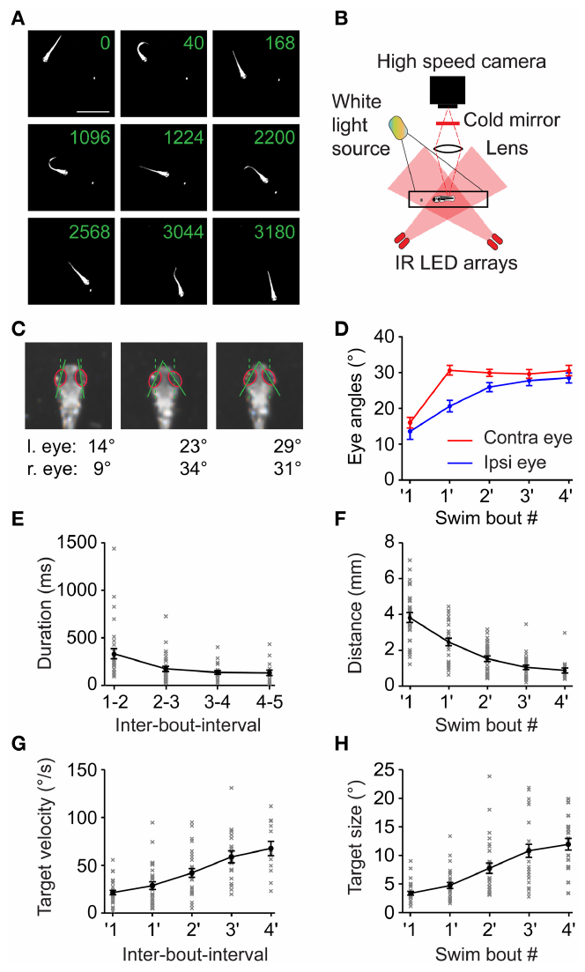
Real prey capture establishes the motor sequence
Trivedi and Bollmann recorded larval zebrafish capturing live paramecia with high-speed video. Capture consisted of separate swimming bouts interrupted by pauses. Early movements oriented the body toward prey, and later movements advanced the fish until a final capture swim.
Automated measurements tracked the fish’s body, the prey and the angles of both eyes. Eye convergence rotates the eyes toward a more forward-facing configuration during capture. The body-to-prey distance declined through the sequence while the prey occupied a progressively larger angle in the visual field.
The pauses between bouts shortened as capture progressed. Approaching prey also moved faster across the visual field and increased in angular size. Recording these coupled changes established the sensory and motor conditions that a controlled virtual-prey task needed to reproduce.
Trivedi & Bollmann (2013), Fig. 1(a–h). Zebrafish prey capture, eye angles and approach measures.
Trivedi & Bollmann (2013)
33
Notes:
• Trivedi and Bollmann recorded larval zebrafish capturing live paramecia with high-speed video. Capture consisted of separate swimming bouts interrupted by pauses. Early movements oriented the body toward prey, and later movements advanced the fish until a final capture swim.
• Automated measurements tracked the fish’s body, the prey and the angles of both eyes. Eye convergence rotates the eyes toward a more forward-facing configuration during capture. The body-to-prey distance declined through the sequence while the prey occupied a progressively larger angle in the visual field.
• The pauses between bouts shortened as capture progressed. Approaching prey also moved faster across the visual field and increased in angular size. Recording these coupled changes established the sensory and motor conditions that a controlled virtual-prey task needed to reproduce.
References:
Trivedi CA, Bollmann JH (2013). Visually driven chaining of elementary swim patterns into a goal-directed motor sequence: a virtual reality study of zebrafish prey capture. Frontiers in Neural Circuits 7:86. https://doi.org/10.3389/fncir.2013.00086
Figure: Trivedi & Bollmann (2013), Fig. 1(a–h). Zebrafish prey capture, eye angles and approach measures.
Figure source: https://doi.org/10.3389/fncir.2013.00086

Slide 34
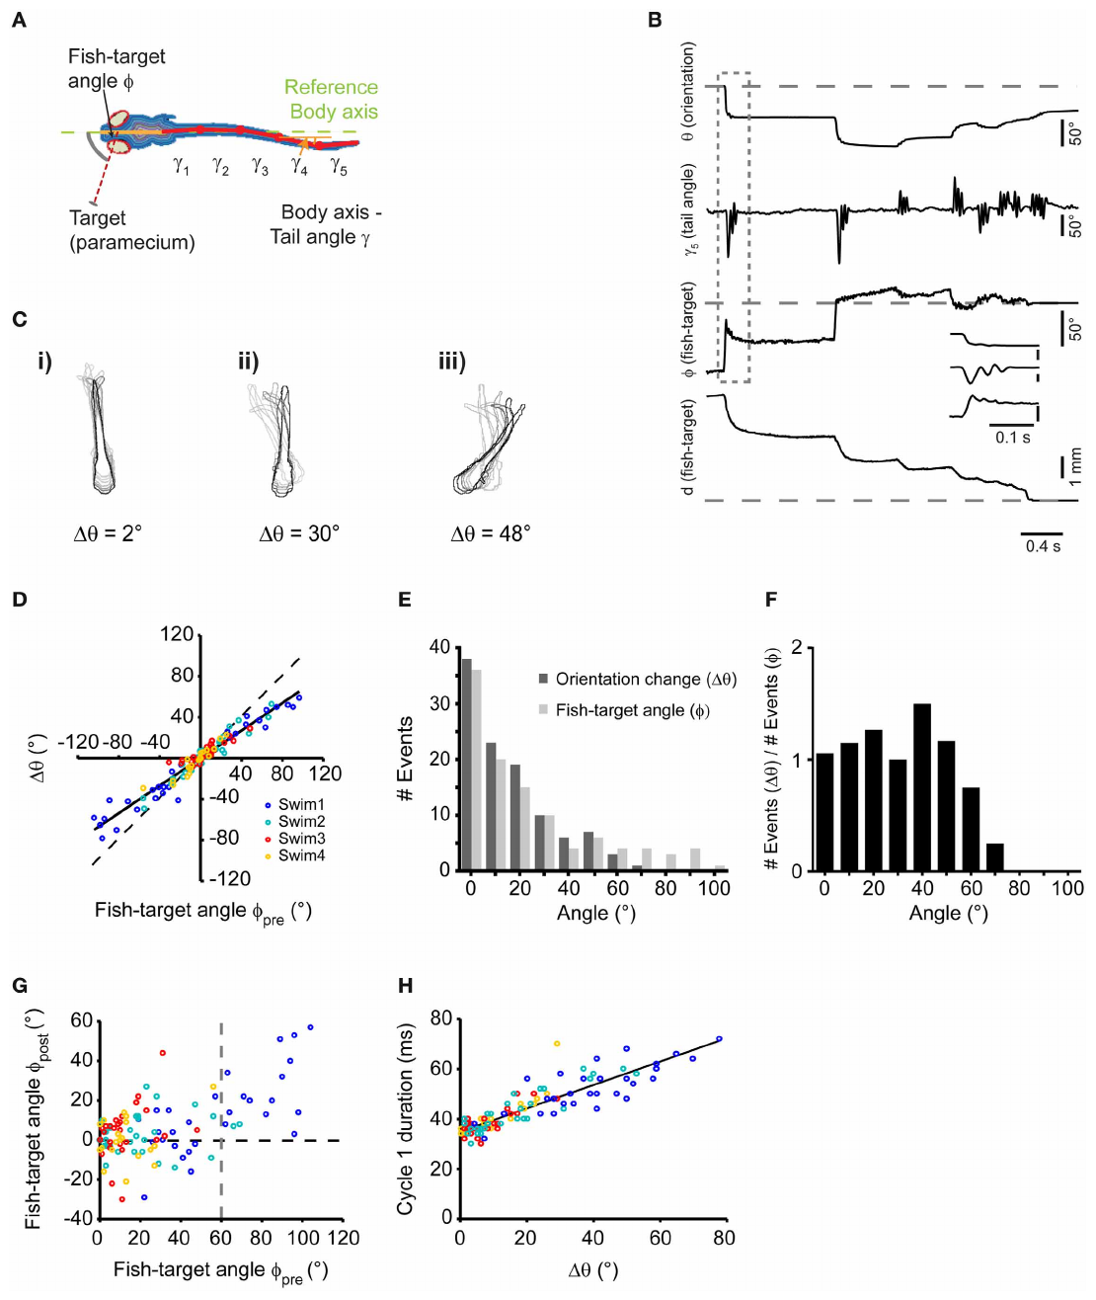
Body landmarks convert a swim into measurable kinematics
Kinematics describes movement without specifying the forces that produce it. Trivedi and Bollmann fitted a segmented midline to larval zebrafish images and measured the deviations of successive tail segments from the body axis. The resulting angle traces distinguished the timing and shape of individual swimming bouts.
Prey position was expressed relative to the fish’s heading, rather than only in camera coordinates. A target to one side required an orienting movement toward that side. The angular change produced by a swim depended on the target’s position immediately before the bout.
Frame-by-frame body measurements linked tail configuration to the change in orientation after each swim. The same parameter definitions could then be applied to restrained larvae responding to displayed prey. A common kinematic description connected the natural behavior with its experimentally controlled counterpart.
Trivedi & Bollmann (2013), Fig. 2(a–h). Body midline, tail angles and target-directed turns.
Trivedi & Bollmann (2013)
34
Notes:
• Kinematics describes movement without specifying the forces that produce it. Trivedi and Bollmann fitted a segmented midline to larval zebrafish images and measured the deviations of successive tail segments from the body axis. The resulting angle traces distinguished the timing and shape of individual swimming bouts.
• Prey position was expressed relative to the fish’s heading, rather than only in camera coordinates. A target to one side required an orienting movement toward that side. The angular change produced by a swim depended on the target’s position immediately before the bout.
• Frame-by-frame body measurements linked tail configuration to the change in orientation after each swim. The same parameter definitions could then be applied to restrained larvae responding to displayed prey. A common kinematic description connected the natural behavior with its experimentally controlled counterpart.
References:
Trivedi CA, Bollmann JH (2013). Visually driven chaining of elementary swim patterns into a goal-directed motor sequence: a virtual reality study of zebrafish prey capture. Frontiers in Neural Circuits 7:86. https://doi.org/10.3389/fncir.2013.00086
Figure: Trivedi & Bollmann (2013), Fig. 2(a–h). Body midline, tail angles and target-directed turns.
Figure source: https://doi.org/10.3389/fncir.2013.00086

Slide 35
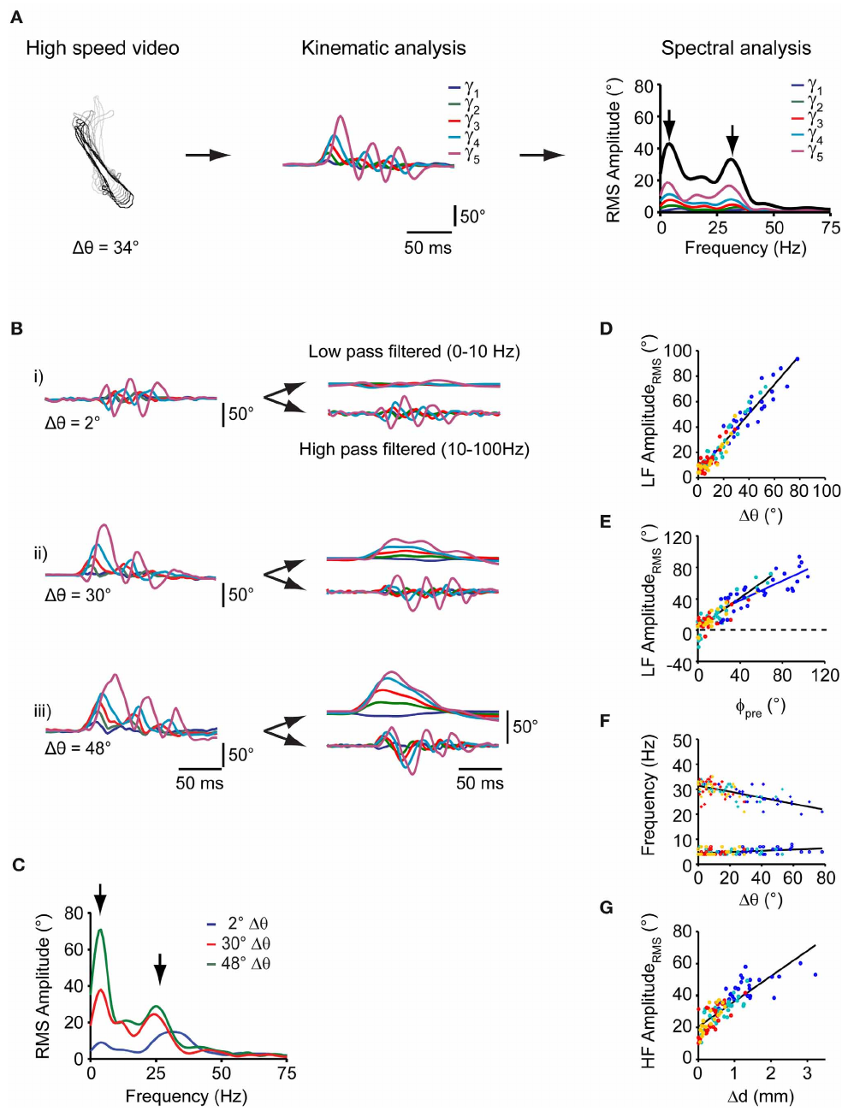
Tail rhythms distinguish orientation from displacement
Spectral analysis separates a changing signal into contributions at different frequencies. Applying it to the zebrafish tail-angle traces identified a low-frequency component near 4 hertz and a higher-frequency component. These components captured different features of the swimming bout.
The low-frequency amplitude increased with the change in body orientation. A pronounced slower bending component therefore accompanied stronger turning. The higher-frequency amplitude was related to the change in fish-to-prey distance, linking faster tail oscillation to approach displacement.
The authors measured these relationships in freely swimming larvae and compared them with responses in a restrained preparation. Similar signal components allowed a tail movement to be classified by its orienting or propulsive contribution. Tracking thus extracted distinct motor features instead of treating every detected bout as equivalent.
Trivedi & Bollmann (2013), Fig. 3(a–g). Tail-angle spectra and relationships to movement.
Trivedi & Bollmann (2013)
35
Notes:
• Spectral analysis separates a changing signal into contributions at different frequencies. Applying it to the zebrafish tail-angle traces identified a low-frequency component near 4 hertz and a higher-frequency component. These components captured different features of the swimming bout.
• The low-frequency amplitude increased with the change in body orientation. A pronounced slower bending component therefore accompanied stronger turning. The higher-frequency amplitude was related to the change in fish-to-prey distance, linking faster tail oscillation to approach displacement.
• The authors measured these relationships in freely swimming larvae and compared them with responses in a restrained preparation. Similar signal components allowed a tail movement to be classified by its orienting or propulsive contribution. Tracking thus extracted distinct motor features instead of treating every detected bout as equivalent.
References:
Trivedi CA, Bollmann JH (2013). Visually driven chaining of elementary swim patterns into a goal-directed motor sequence: a virtual reality study of zebrafish prey capture. Frontiers in Neural Circuits 7:86. https://doi.org/10.3389/fncir.2013.00086
Figure: Trivedi & Bollmann (2013), Fig. 3(a–g). Tail-angle spectra and relationships to movement.
Figure source: https://doi.org/10.3389/fncir.2013.00086

Slide 36
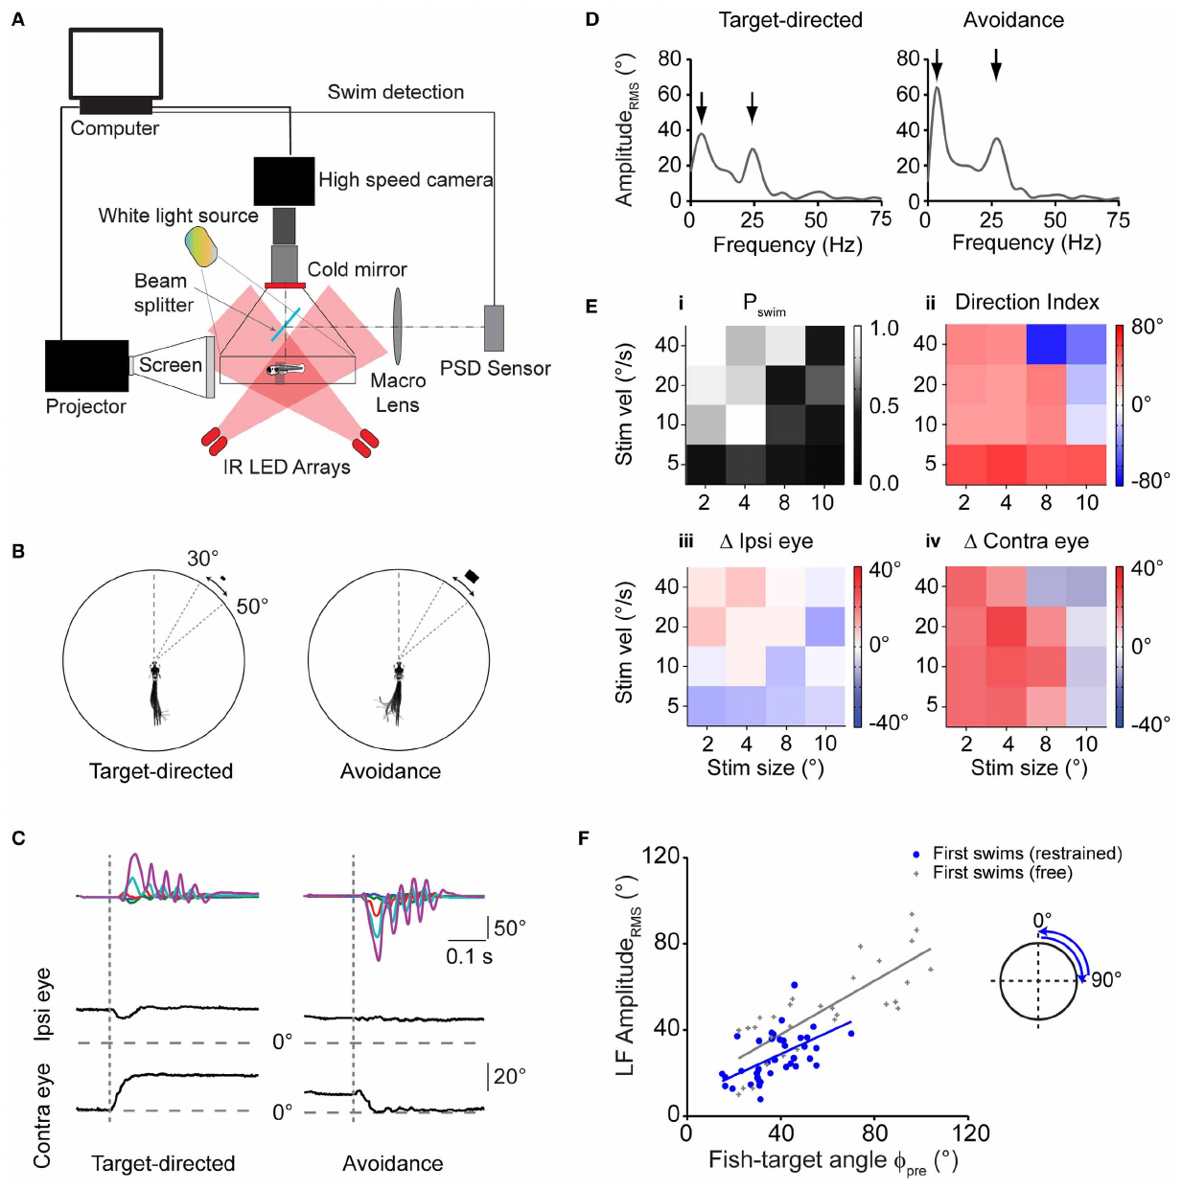
Target geometry can switch approach into avoidance
Minimal restraint kept the larva’s eyes and tail free while holding its position relative to a visual display. The experimenters presented moving rectangles with controlled angular size and speed. Angular size measures the extent of a stimulus in the animal’s visual field rather than its physical dimensions on the screen.
A small target measuring 2 by 1 degrees and moving at 20 degrees per second elicited target-directed turning. A larger target measuring 8 by 4 degrees and moving at 40 degrees per second elicited turning away. Eye movements and tail-angle analysis accompanied these different motor responses.
Systematic variation of size and velocity identified combinations that promoted approach or avoidance. A visual object consequently acquired behavioral meaning through its sensory parameters. Calling an object virtual prey required evidence from the animal’s response rather than resemblance to prey from a human observer’s perspective.
Trivedi & Bollmann (2013), Fig. 4(a–f). Restrained larvae responding to different visual targets.
Trivedi & Bollmann (2013)
36
Notes:
• Minimal restraint kept the larva’s eyes and tail free while holding its position relative to a visual display. The experimenters presented moving rectangles with controlled angular size and speed. Angular size measures the extent of a stimulus in the animal’s visual field rather than its physical dimensions on the screen.
• A small target measuring 2 by 1 degrees and moving at 20 degrees per second elicited target-directed turning. A larger target measuring 8 by 4 degrees and moving at 40 degrees per second elicited turning away. Eye movements and tail-angle analysis accompanied these different motor responses.
• Systematic variation of size and velocity identified combinations that promoted approach or avoidance. A visual object consequently acquired behavioral meaning through its sensory parameters. Calling an object virtual prey required evidence from the animal’s response rather than resemblance to prey from a human observer’s perspective.
References:
Trivedi CA, Bollmann JH (2013). Visually driven chaining of elementary swim patterns into a goal-directed motor sequence: a virtual reality study of zebrafish prey capture. Frontiers in Neural Circuits 7:86. https://doi.org/10.3389/fncir.2013.00086
Figure: Trivedi & Bollmann (2013), Fig. 4(a–f). Restrained larvae responding to different visual targets.
Figure source: https://doi.org/10.3389/fncir.2013.00086

Slide 37
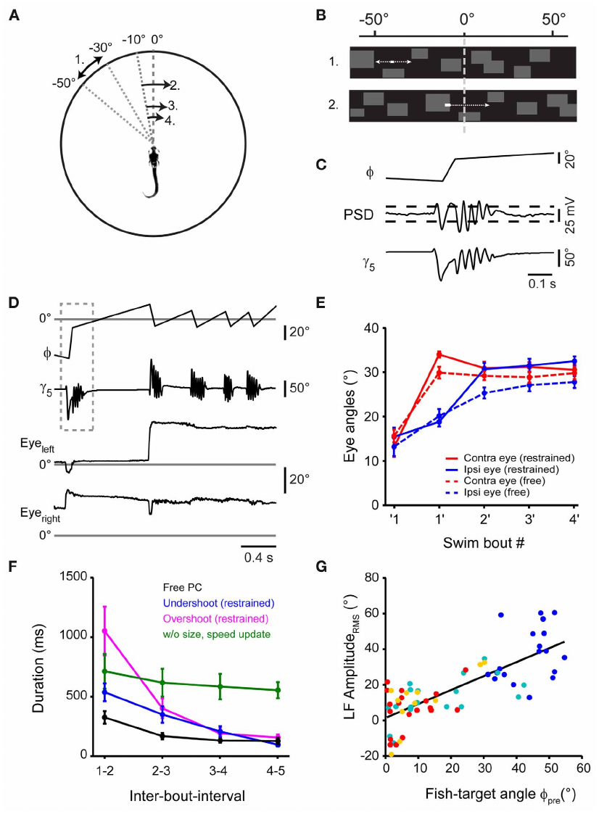
Optical signals align detected bouts with video
A position-sensitive detector measured an optical signal associated with tail movement in restrained zebrafish. Trivedi and Bollmann compared this signal with tail angles extracted from high-speed video. A threshold crossing supplied a rapid bout-detection event while the video retained the movement’s detailed shape.
The two readouts served different measurement purposes. The detector identified an event quickly enough to trigger a display update; body tracking described which tail segments moved and when. Aligning their time courses tied the fast sensor event to the motor behavior visible in the recording.
The resulting alignment placed stimulus position, detector voltage and tail-angle changes on a common time axis. That synchronization made the timing of a sensory intervention experimentally interpretable. A sensor threshold alone would identify an event without preserving the full kinematic evidence for the action that caused it.
Trivedi & Bollmann (2013), Fig. 5(a–g). Swim detection and stimulus updates in the closed loop.
Trivedi & Bollmann (2013)
37
Notes:
• A position-sensitive detector measured an optical signal associated with tail movement in restrained zebrafish. Trivedi and Bollmann compared this signal with tail angles extracted from high-speed video. A threshold crossing supplied a rapid bout-detection event while the video retained the movement’s detailed shape.
• The two readouts served different measurement purposes. The detector identified an event quickly enough to trigger a display update; body tracking described which tail segments moved and when. Aligning their time courses tied the fast sensor event to the motor behavior visible in the recording.
• The resulting alignment placed stimulus position, detector voltage and tail-angle changes on a common time axis. That synchronization made the timing of a sensory intervention experimentally interpretable. A sensor threshold alone would identify an event without preserving the full kinematic evidence for the action that caused it.
References:
Trivedi CA, Bollmann JH (2013). Visually driven chaining of elementary swim patterns into a goal-directed motor sequence: a virtual reality study of zebrafish prey capture. Frontiers in Neural Circuits 7:86. https://doi.org/10.3389/fncir.2013.00086
Figure: Trivedi & Bollmann (2013), Fig. 5(a–g). Swim detection and stimulus updates in the closed loop.
Figure source: https://doi.org/10.3389/fncir.2013.00086

Slide 38
Eye convergence accompanies the simulated approach
Trivedi and Bollmann compared eye angles during capture of real paramecia with angles during virtual-prey sequences. The restrained preparation permitted high-resolution tracking while the displayed target changed after detected swims. Eye convergence supplied an additional motor readout beyond the presence of a tail bout.
Larvae produced repeated target-directed swims and increasing eye convergence in this closed-loop condition. The resulting sequence resembled the progressive approach measured with live prey. Sensory changes caused by one bout helped organize the timing and configuration of later bouts.
A comparison condition held target size and speed constant. Its altered inter-bout timing connected the sequence to updated visual information rather than to a fixed count of preceding swims. Combining eye angles and bout timing distinguished a coordinated capture-like sequence from an isolated orienting movement.
Trivedi & Bollmann (2013), Fig. 5(a–g). Increasing target size and speed during virtual-prey approach.
Trivedi & Bollmann (2013)
38
Notes:
• Trivedi and Bollmann compared eye angles during capture of real paramecia with angles during virtual-prey sequences. The restrained preparation permitted high-resolution tracking while the displayed target changed after detected swims. Eye convergence supplied an additional motor readout beyond the presence of a tail bout.
• Larvae produced repeated target-directed swims and increasing eye convergence in this closed-loop condition. The resulting sequence resembled the progressive approach measured with live prey. Sensory changes caused by one bout helped organize the timing and configuration of later bouts.
• A comparison condition held target size and speed constant. Its altered inter-bout timing connected the sequence to updated visual information rather than to a fixed count of preceding swims. Combining eye angles and bout timing distinguished a coordinated capture-like sequence from an isolated orienting movement.
References:
Trivedi CA, Bollmann JH (2013). Visually driven chaining of elementary swim patterns into a goal-directed motor sequence: a virtual reality study of zebrafish prey capture. Frontiers in Neural Circuits 7:86. https://doi.org/10.3389/fncir.2013.00086
Figure: Trivedi & Bollmann (2013), Fig. 5(a–g). Increasing target size and speed during virtual-prey approach.
Figure source: https://doi.org/10.3389/fncir.2013.00086

Slide 39
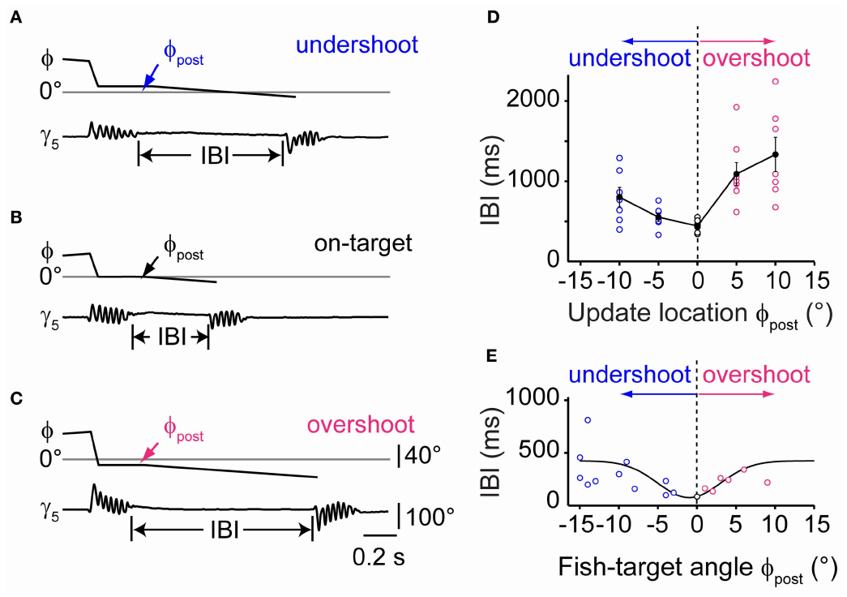
Residual target error predicts motor readiness
Turning error is the target’s angular displacement from the heading after an orienting movement. Trivedi and Bollmann imposed different apparent outcomes of a detected swim: the target could remain short of the midline, arrive at the midline or pass beyond it. These updates simulated undershoot, alignment and overshoot.
The interval before the next swim was shortest when the target was near alignment. Updates approximately 10 degrees short of or beyond the midline delayed the subsequent bout. Real prey-capture recordings also linked shorter intervals to smaller residual turning error.
Changing the feedback mapping altered the motor sequence even though the detected action had already occurred. The next bout depended on the target’s updated sensory position. Closed-loop mapping therefore formed part of the behavioral mechanism, rather than serving only as a display convenience.
Trivedi & Bollmann (2013), Fig. 6(a–e). Undershoot, alignment and overshoot in the virtual task.
Trivedi & Bollmann (2013)
39
Notes:
• Turning error is the target’s angular displacement from the heading after an orienting movement. Trivedi and Bollmann imposed different apparent outcomes of a detected swim: the target could remain short of the midline, arrive at the midline or pass beyond it. These updates simulated undershoot, alignment and overshoot.
• The interval before the next swim was shortest when the target was near alignment. Updates approximately 10 degrees short of or beyond the midline delayed the subsequent bout. Real prey-capture recordings also linked shorter intervals to smaller residual turning error.
• Changing the feedback mapping altered the motor sequence even though the detected action had already occurred. The next bout depended on the target’s updated sensory position. Closed-loop mapping therefore formed part of the behavioral mechanism, rather than serving only as a display convenience.
References:
Trivedi CA, Bollmann JH (2013). Visually driven chaining of elementary swim patterns into a goal-directed motor sequence: a virtual reality study of zebrafish prey capture. Frontiers in Neural Circuits 7:86. https://doi.org/10.3389/fncir.2013.00086
Figure: Trivedi & Bollmann (2013), Fig. 6(a–e). Undershoot, alignment and overshoot in the virtual task.
Figure source: https://doi.org/10.3389/fncir.2013.00086

Slide 40
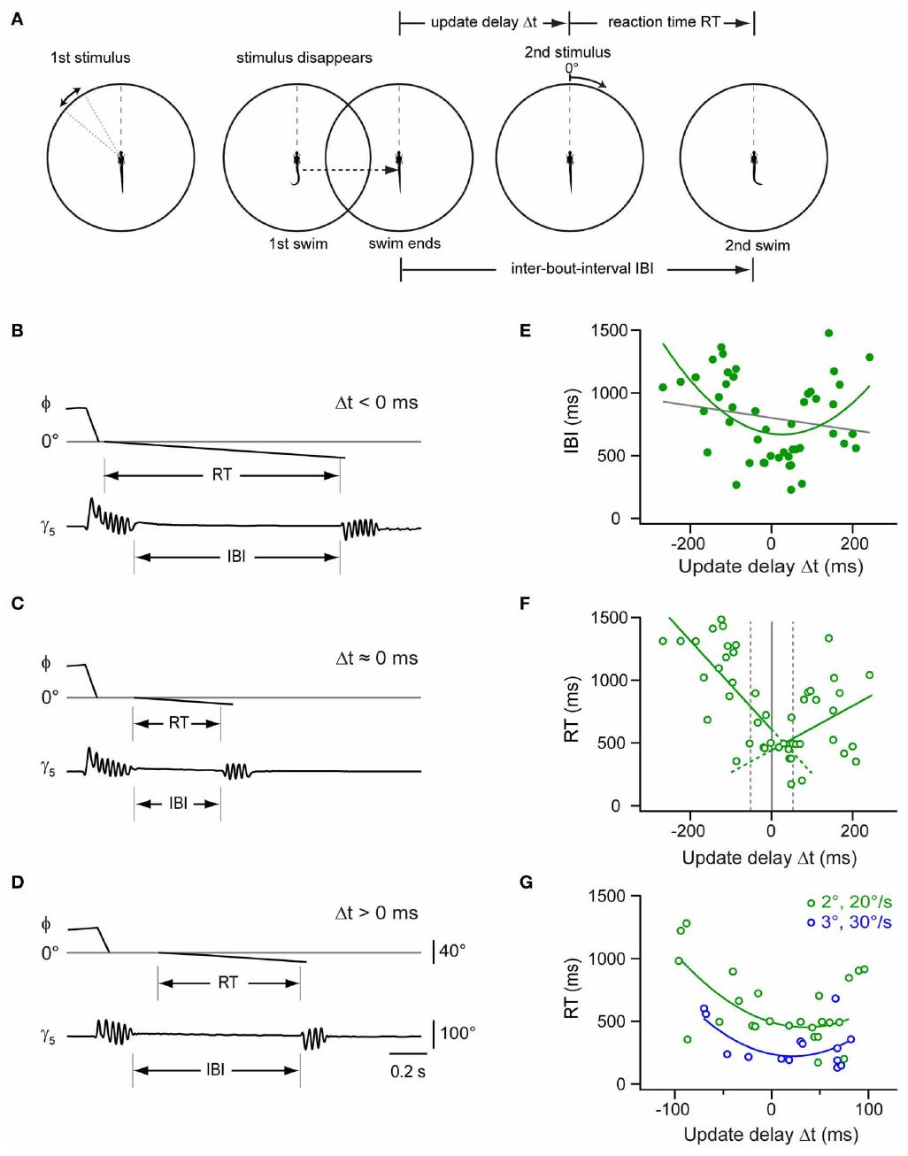
Movement phase changes visual reaction time
The investigators presented a second target at different times relative to the end of an initial swim. Inter-bout interval is the elapsed time between successive motor bouts, while reaction time is measured from the appearance of the new stimulus. These measures use different temporal reference points.
Presenting the target near the end of the first bout produced the shortest inter-bout intervals. Earlier or later presentation lengthened the sequence’s pause. The result linked stimulus timing to ongoing motor activity, rather than treating a visual response as independent of the preceding movement.
A larger, faster second target produced shorter reaction times than the smaller, slower comparison. Both the timing and sensory properties of feedback shaped the next action. A virtual task therefore needed to preserve the relation between movement phase and the visual event delivered in response.
Trivedi & Bollmann (2013), Fig. 7(a–g). Stimulus timing and the interval between swims.
Trivedi & Bollmann (2013)
40
Notes:
• The investigators presented a second target at different times relative to the end of an initial swim. Inter-bout interval is the elapsed time between successive motor bouts, while reaction time is measured from the appearance of the new stimulus. These measures use different temporal reference points.
• Presenting the target near the end of the first bout produced the shortest inter-bout intervals. Earlier or later presentation lengthened the sequence’s pause. The result linked stimulus timing to ongoing motor activity, rather than treating a visual response as independent of the preceding movement.
• A larger, faster second target produced shorter reaction times than the smaller, slower comparison. Both the timing and sensory properties of feedback shaped the next action. A virtual task therefore needed to preserve the relation between movement phase and the visual event delivered in response.
References:
Trivedi CA, Bollmann JH (2013). Visually driven chaining of elementary swim patterns into a goal-directed motor sequence: a virtual reality study of zebrafish prey capture. Frontiers in Neural Circuits 7:86. https://doi.org/10.3389/fncir.2013.00086
Figure: Trivedi & Bollmann (2013), Fig. 7(a–g). Stimulus timing and the interval between swims.
Figure source: https://doi.org/10.3389/fncir.2013.00086

Slide 41
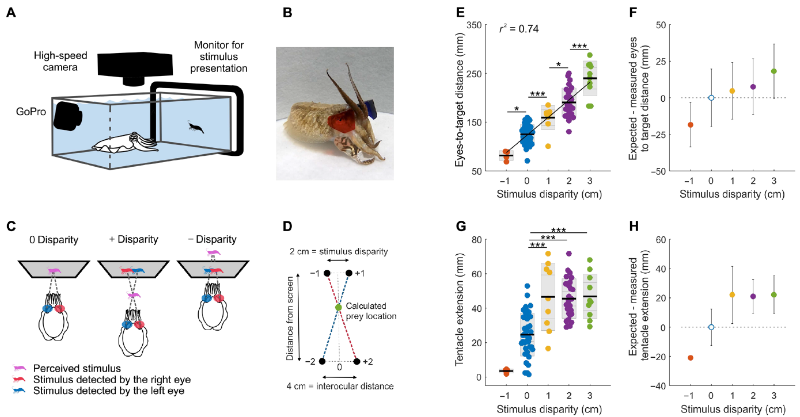
Body placement provides a depth-dependent readout
Feord and colleagues delivered eye-specific moving shrimp images to cuttlefish through colored filters. Binocular disparity, the difference between the two eyes’ images, ranged from negative to positive values. Increasing positive disparity placed the apparent prey in front of the screen under the tested geometry. Cuttlefish positioned themselves farther from the screen before launching their tentacles.
A ballistic movement is a rapid movement whose initial execution depends strongly on the preceding preparation. The experiment measured eye-to-screen distance when this strike began. Incorporating each animal’s interocular distance, the separation between its eyes, allowed comparison with the target location predicted from stereoscopic geometry.
The animals maintained a consistent relationship to the inferred prey position across disparity conditions. Their body placement therefore changed with the eye-specific depth cue. The physical monitor remained fixed while the animal behaved as though the relevant target distance had changed.
Feord et al. (2020), Fig. 1(a–h). Strike position and tentacle extension versus disparity.
Feord et al. (2020)
41
Notes:
• Feord and colleagues delivered eye-specific moving shrimp images to cuttlefish through colored filters. Binocular disparity, the difference between the two eyes’ images, ranged from negative to positive values. Increasing positive disparity placed the apparent prey in front of the screen under the tested geometry. Cuttlefish positioned themselves farther from the screen before launching their tentacles.
• A ballistic movement is a rapid movement whose initial execution depends strongly on the preceding preparation. The experiment measured eye-to-screen distance when this strike began. Incorporating each animal’s interocular distance, the separation between its eyes, allowed comparison with the target location predicted from stereoscopic geometry.
• The animals maintained a consistent relationship to the inferred prey position across disparity conditions. Their body placement therefore changed with the eye-specific depth cue. The physical monitor remained fixed while the animal behaved as though the relevant target distance had changed.
References:
Feord RC, Sumner ME, Pusdekar S, Kalra L, Gonzalez-Bellido PT, Wardill TJ (2020). Cuttlefish use stereopsis to strike at prey. Science Advances 6:eaay6036. https://doi.org/10.1126/sciadv.aay6036
Figure: Feord et al. (2020), Fig. 1(a–h). Strike position and tentacle extension versus disparity.
Figure source: https://doi.org/10.1126/sciadv.aay6036

Slide 42
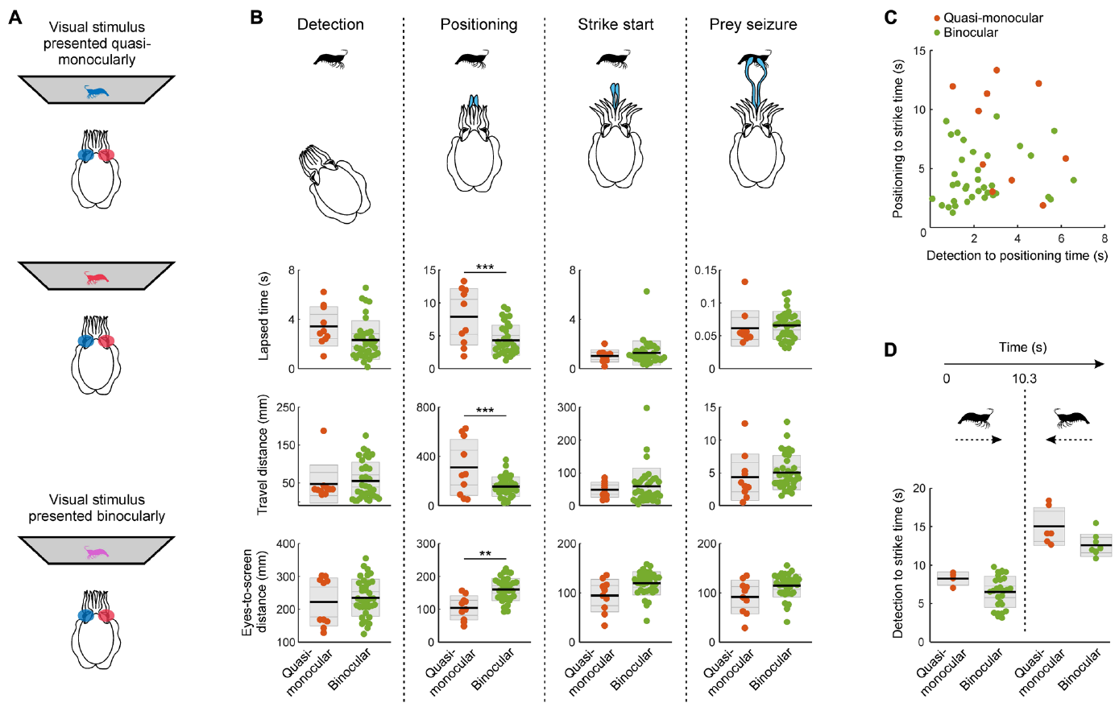
Time budgets localize a perceptual impairment
Cuttlefish hunting was divided into detection, positioning, strike initiation and prey seizure. Detection began with the first reaction to the displayed target. Positioning included movement into the location and orientation used to launch the tentacles.
The researchers measured elapsed time, distance traveled and eye-to-screen distance in each stage. These separate readouts distinguished finding the target from deciding where to strike it. A total trial duration would combine processes that responded differently to changes in visual information.
Comparing the stages localized the effect of reduced binocular information mainly to positioning. Detection and later strike phases were more similar across the tested conditions. The behavioral sequence therefore supplied a more specific account of sensory use than a single success-or-failure score.
Feord et al. (2020), Fig. 2(a–d). Detection, positioning, strike and seizure stages.
Feord et al. (2020)
42
Notes:
• Cuttlefish hunting was divided into detection, positioning, strike initiation and prey seizure. Detection began with the first reaction to the displayed target. Positioning included movement into the location and orientation used to launch the tentacles.
• The researchers measured elapsed time, distance traveled and eye-to-screen distance in each stage. These separate readouts distinguished finding the target from deciding where to strike it. A total trial duration would combine processes that responded differently to changes in visual information.
• Comparing the stages localized the effect of reduced binocular information mainly to positioning. Detection and later strike phases were more similar across the tested conditions. The behavioral sequence therefore supplied a more specific account of sensory use than a single success-or-failure score.
References:
Feord RC, Sumner ME, Pusdekar S, Kalra L, Gonzalez-Bellido PT, Wardill TJ (2020). Cuttlefish use stereopsis to strike at prey. Science Advances 6:eaay6036. https://doi.org/10.1126/sciadv.aay6036
Figure: Feord et al. (2020), Fig. 2(a–d). Detection, positioning, strike and seizure stages.
Figure source: https://doi.org/10.1126/sciadv.aay6036

Slide 43
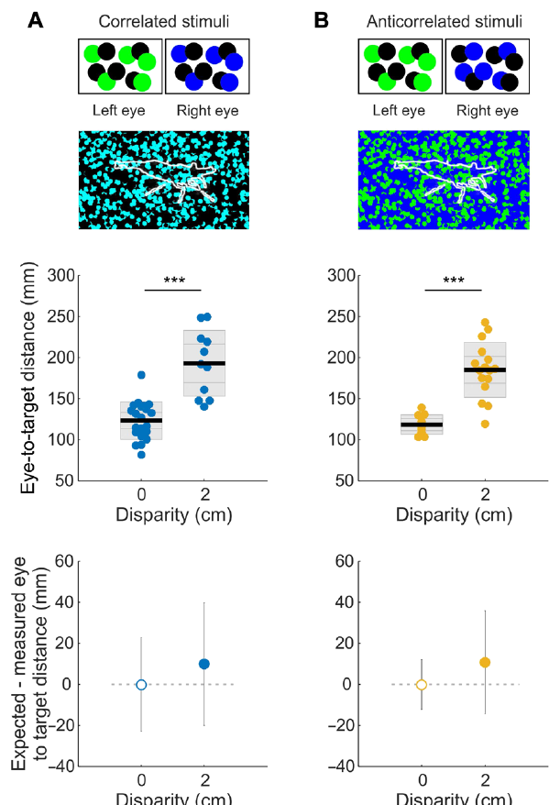
Motion can reveal prey hidden in a dot pattern
The researchers concealed a shrimp-shaped region within a background of random dots. In a static frame, the target had no ordinary outline or contrasting fill. Its motion created information that distinguished the prey region from the surrounding pattern.
The two eyes received manipulated versions of the dot display. Correlation described whether corresponding dots had matching contrast across the eyes. Disparity could then be changed while the prey remained defined through movement rather than a conventional colored silhouette.
Cuttlefish detected and struck at targets in appropriate correlated conditions. Motion-defined prey thus provided usable information even when a human-designed static outline was removed. The experiment tested the animal’s visual computation through controlled image relationships, rather than judging stimulus suitability solely by human appearance.
Feord et al. (2020), Fig. 3(a–b). Correlated and anticorrelated dot stimuli.
Feord et al. (2020)
43
Notes:
• The researchers concealed a shrimp-shaped region within a background of random dots. In a static frame, the target had no ordinary outline or contrasting fill. Its motion created information that distinguished the prey region from the surrounding pattern.
• The two eyes received manipulated versions of the dot display. Correlation described whether corresponding dots had matching contrast across the eyes. Disparity could then be changed while the prey remained defined through movement rather than a conventional colored silhouette.
• Cuttlefish detected and struck at targets in appropriate correlated conditions. Motion-defined prey thus provided usable information even when a human-designed static outline was removed. The experiment tested the animal’s visual computation through controlled image relationships, rather than judging stimulus suitability solely by human appearance.
References:
Feord RC, Sumner ME, Pusdekar S, Kalra L, Gonzalez-Bellido PT, Wardill TJ (2020). Cuttlefish use stereopsis to strike at prey. Science Advances 6:eaay6036. https://doi.org/10.1126/sciadv.aay6036
Figure: Feord et al. (2020), Fig. 3(a–b). Correlated and anticorrelated dot stimuli.
Figure source: https://doi.org/10.1126/sciadv.aay6036

Slide 44
Contrast reversal tests interocular image comparison
In an anticorrelated display, a bright dot in one eye’s image corresponded to a dark dot in the other eye’s image. This reverses local contrast while retaining a systematic relation between the two images. An uncorrelated display instead supplied unrelated dot patterns to the two eyes.
Cuttlefish adjusted their strike position appropriately with correlated and anticorrelated prey patterns. Uncorrelated patterns did not support the same depth-dependent response. The presence of an organized interocular relationship mattered even when the signs of corresponding contrasts were reversed.
The authors used these conditions to probe the computation underlying stereopsis. The behavioral result distinguished sensitivity to matching image structure from a requirement that matching points have identical brightness. A proposed explanation of the mechanism must account for both successful contrast reversal and failure with unrelated patterns.
Feord et al. (2020), Fig. 3(a–b). Depth responses to interocular dot relationships.
Feord et al. (2020)
44
Notes:
• In an anticorrelated display, a bright dot in one eye’s image corresponded to a dark dot in the other eye’s image. This reverses local contrast while retaining a systematic relation between the two images. An uncorrelated display instead supplied unrelated dot patterns to the two eyes.
• Cuttlefish adjusted their strike position appropriately with correlated and anticorrelated prey patterns. Uncorrelated patterns did not support the same depth-dependent response. The presence of an organized interocular relationship mattered even when the signs of corresponding contrasts were reversed.
• The authors used these conditions to probe the computation underlying stereopsis. The behavioral result distinguished sensitivity to matching image structure from a requirement that matching points have identical brightness. A proposed explanation of the mechanism must account for both successful contrast reversal and failure with unrelated patterns.
References:
Feord RC, Sumner ME, Pusdekar S, Kalra L, Gonzalez-Bellido PT, Wardill TJ (2020). Cuttlefish use stereopsis to strike at prey. Science Advances 6:eaay6036. https://doi.org/10.1126/sciadv.aay6036
Figure: Feord et al. (2020), Fig. 3(a–b). Depth responses to interocular dot relationships.
Figure source: https://doi.org/10.1126/sciadv.aay6036

Slide 45
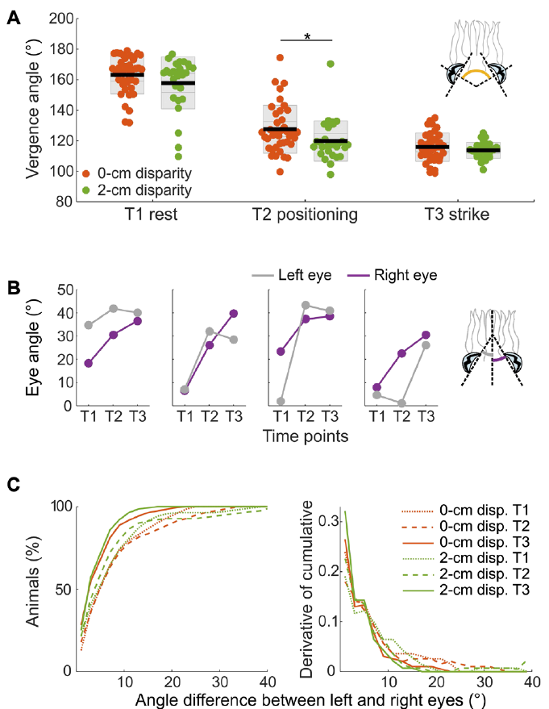
Independent eye movements accompany binocular hunting
Feord and colleagues measured the orientation of both cuttlefish eyes during hunting. Vergence describes the relative angle of the eyes, which determines how their visual fields overlap. The eyes moved independently rather than remaining locked into a symmetric orientation throughout the approach.
Immediately before a strike, eye orientation could differ by as much as about 10 degrees from the midline. Binocular depth-guided behavior therefore occurred alongside asymmetric eye positions. The experiment measured actual gaze geometry instead of assuming that the animal always centered both eyes identically on the displayed target.
Eye-specific stimulation, body positioning and tentacle extension together connected sensory input to action. Tracking the relevant organs was necessary for describing the input that the animal received. An interactive visual task depended on the animal’s own viewing geometry as well as the computer’s programmed images.
Feord et al. (2020), Fig. 4(a–c). Eye positions and asymmetry during prey strikes.
Feord et al. (2020)
45
Notes:
• Feord and colleagues measured the orientation of both cuttlefish eyes during hunting. Vergence describes the relative angle of the eyes, which determines how their visual fields overlap. The eyes moved independently rather than remaining locked into a symmetric orientation throughout the approach.
• Immediately before a strike, eye orientation could differ by as much as about 10 degrees from the midline. Binocular depth-guided behavior therefore occurred alongside asymmetric eye positions. The experiment measured actual gaze geometry instead of assuming that the animal always centered both eyes identically on the displayed target.
• Eye-specific stimulation, body positioning and tentacle extension together connected sensory input to action. Tracking the relevant organs was necessary for describing the input that the animal received. An interactive visual task depended on the animal’s own viewing geometry as well as the computer’s programmed images.
References:
Feord RC, Sumner ME, Pusdekar S, Kalra L, Gonzalez-Bellido PT, Wardill TJ (2020). Cuttlefish use stereopsis to strike at prey. Science Advances 6:eaay6036. https://doi.org/10.1126/sciadv.aay6036
Figure: Feord et al. (2020), Fig. 4(a–c). Eye positions and asymmetry during prey strikes.
Figure source: https://doi.org/10.1126/sciadv.aay6036

Slide 46
Key takeaways
Validated welfare indicators Mouse facial classification gains biological meaning from baseline, injury, state and analgesic comparisons.
Pose and identity Landmark localization, grouping into bodies and identification across time are distinct computational problems.
Measurement timing Inference benchmarks, hardware delay and behavioral response latency measure different parts of an intervention pipeline.
Participation and motivation Self-initiated task entry and reward-dependent trial numbers measure participation; essential-resource contingencies still constrain task design.
Kinematic validation Zebrafish eye angles, tail rhythms and bout intervals distinguish coordinated capture-like behavior from any detected movement.
Animal-specific perception Cuttlefish disparity and motion-defined targets test visual computations through the animal’s behavior and viewing geometry.
Tuttle et al. (2018); Lauer et al. (2022); Pereira et al. (2022); Erskine et al. (2019); Trivedi & Bollmann (2013); Feord et al. (2020)
46
Notes:
Lauer J, Zhou M, Ye S, Menegas W, Schneider S, Nath T, Rahman MM, Di Santo V, Soberanes D, Feng G, Murthy VN, Lauder G, Dulac C, Mathis MW, Mathis A (2022). Multi-animal pose estimation, identification and tracking with DeepLabCut. Nature Methods 19:496-504. https://doi.org/10.1038/s41592-022-01443-0
Pereira TD, Tabris N, Matsliah A, Turner DM, Li J, Ravindranath S, Papadoyannis ES, Normand E, Deutsch DS, Wang ZY, McKenzie-Smith GC, Mitelut CC, Castro MD, D’Uva J, Kislin M, Sanes DH, Kocher SD, Wang SSH, Falkner AL, Shaevitz JW, Murthy M (2022). SLEAP: A deep learning system for multi-animal pose tracking. Nature Methods 19:486-495. https://doi.org/10.1038/s41592-022-01426-1
Tuttle AH, Molinaro MJ, Jethwa JF, Sotocinal SG, Prieto JC, Styner MA, Mogil JS, Zylka MJ (2018). A deep neural network to assess spontaneous pain from mouse facial expressions. Molecular Pain 14:1744806918763658. https://doi.org/10.1177/1744806918763658
Erskine A, Bus T, Herb JT, Schaefer AT (2019). AutonoMouse: High throughput operant conditioning reveals progressive impairment with graded olfactory bulb lesions. PLOS ONE 14:e0211571. https://doi.org/10.1371/journal.pone.0211571
Trivedi CA, Bollmann JH (2013). Visually driven chaining of elementary swim patterns into a goal-directed motor sequence: a virtual reality study of zebrafish prey capture. Frontiers in Neural Circuits 7:86. https://doi.org/10.3389/fncir.2013.00086
Feord RC, Sumner ME, Pusdekar S, Kalra L, Gonzalez-Bellido PT, Wardill TJ (2020). Cuttlefish use stereopsis to strike at prey. Science Advances 6:eaay6036. https://doi.org/10.1126/sciadv.aay6036

