Slide 1
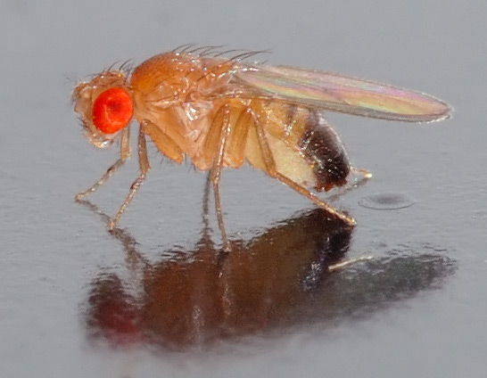
NEUR 411 · NEUROETHOLOGY · FALL 2026
Lecture 11
Insect vision I:
the fly optomotor response and the Reichardt elementary motion detector
Friday, September 18, 2026
Jordan Lopez, Ph.D.
Professor of Neurobiology & Biomedical Engineering
Photo: Drosophila melanogaster, the fruit fly used in the motion-vision experiments.
Notes:
Insect vision I: the fly optomotor response and the Reichardt elementary motion detector
Lecture 11. NEUR 411 · NEUROETHOLOGY · FALL 2026. Friday, September 18, 2026.
Image: Photo: Drosophila melanogaster, the fruit fly used in the motion-vision experiments. Credit: André Karwath. License: CC BY-SA 2.5. Source: https://commons.wikimedia.org/wiki/File:Drosophila_melanogaster_-_side_(aka).jpg

Slide 2
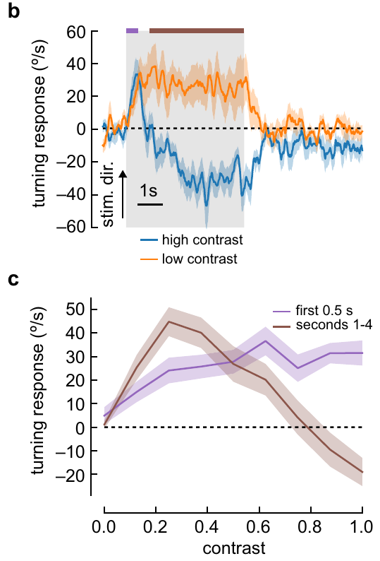
Flies turn with rotating visual patterns
The optomotor response is a turn in the direction of a rotating visual pattern. Such turns can reduce retinal slip, the movement of the environmental image across the eye during unintended body rotation. Turning direction therefore links visual motion to a measurable motor response.
Mano and colleagues measured tethered Drosophila melanogaster walking on an air-supported ball. A panoramic display covered 270°; ball rotation provided turning velocity in degrees per second while the fly remained at a fixed position.
At contrast 0.25, a sinusoidal grating with wavelength 60° moving at 1 Hz elicited sustained turning with the pattern. At contrast 1.0, turning changed direction after approximately 1 s. Optomotor behavior depends on stimulus conditions and elapsed time.
Mano et al. (2023), Fig. 1(b, c). Contrast changes turning during a 5-s rotating pattern.
Mano et al. (2023)
02
Notes:
• Retinal slip is visual image movement caused by motion between the animal and its surroundings. Turning with a drifting panorama can compensate for unintended body rotation, so the same visual stimulus can be related directly to a steering response.
• The fly walked on a ball rather than moving through the arena. Optical measurements of ball rotation supplied a turning velocity, while the experimenter controlled the visual panorama independently. This is an open-loop measurement because the animal's turns did not cancel the imposed pattern motion.
• The two contrast conditions differed in their long-term response even though their wavelength and temporal frequency matched. A response measured during the first half-second can therefore differ from one averaged across the entire five-second stimulus.
References:
Mano O, Choi M, Tanaka R, Creamer MS, Matos NCB, Shomar JW, Badwan BA, Clandinin TR, Clark DA (2023). Long-timescale anti-directional rotation in <i>Drosophila</i> optomotor behavior. eLife 12:e86076. https://doi.org/10.7554/elife.86076
Figure: Mano et al. (2023), Fig. 1(b, c). Contrast changes turning during a 5-s rotating pattern.
Figure source: https://doi.org/10.7554/elife.86076

Slide 3
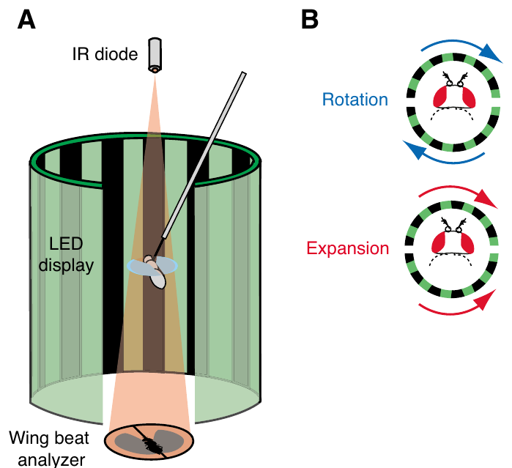
Controlled optic flow separates rotation from expansion
Optic flow is the pattern of image motion across the visual field. Duistermars and colleagues compared panoramic rotation with an expansion cue in tethered flying Drosophila. Rotation carried stripes in one direction around the fly; expansion reversed motion in the rear hemisphere.
Infrared light cast wing shadows onto sensors. The difference between left and right wingbeat amplitudes, ΔWBA, provided a steering measure proportional to yaw torque, the rotational force about the vertical body axis. The recorded voltage was a calibrated proxy for steering, not a body angle.
Each 3-s test followed closed-loop control of a vertical stripe. The expansion stimulus was an approximation to translation, with an abrupt velocity reversal between hemispheres, rather than the smooth flow field of natural forward flight.
Duistermars et al. (2007), Fig. 1. Tethered-flight apparatus and two panoramic flow fields.
Duistermars et al. (2007)
03
Notes:
• Rotation and translation produce different distributions of motion over the eye. The experiment changed the rear half of the panorama while keeping the front motion comparable, allowing the two flow arrangements to be tested with the same recording apparatus.
• A tethered fly can change its wing movements even though it cannot physically yaw. Comparing the two wing amplitudes gives a motor readout of attempted steering. The voltage axis reports the analyzer's output rather than degrees of actual rotation.
• Closed-loop stripe fixation kept the flies engaged before each open-loop test. Because the expansion cue used a square-wave velocity profile across azimuth, the result applies directly to this controlled approximation and should not be equated with every possible translational flow field.
References:
Duistermars BJ, Chow DM, Condro M, Frye MA (2007). The spatial, temporal and contrast properties of expansion and rotation flight optomotor responses in Drosophila. Journal of Experimental Biology 210:3218-3227. https://doi.org/10.1242/jeb.007807
Figure: Duistermars et al. (2007), Fig. 1. Tethered-flight apparatus and two panoramic flow fields.
Figure source: https://doi.org/10.1242/jeb.007807

Slide 4
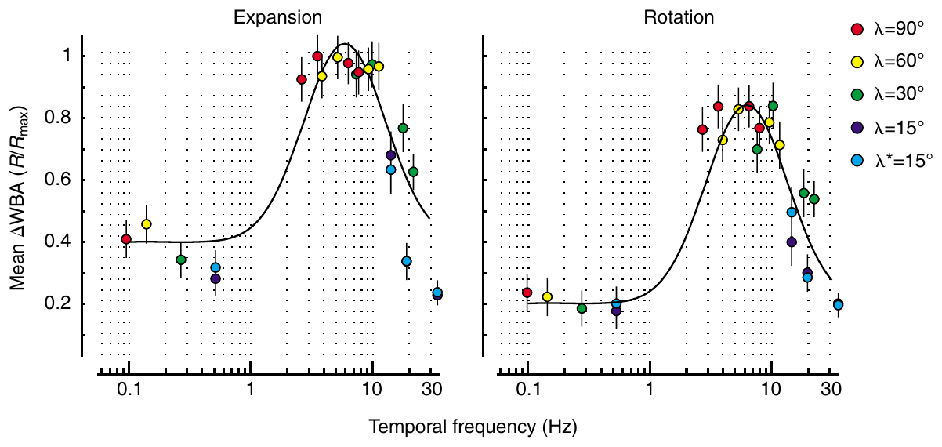
Motion tuning depends on space and time
A grating's spatial wavelength is the angular distance between repeating stripes. Its temporal frequency is the number of pattern cycles passing a retinal position each second. A pattern's speed alone therefore does not specify the stimulation reaching the visual system.
Duistermars and colleagues varied wavelengths from 15° to 90° and pattern speeds from 10 to 431°/s. These combinations sampled approximately 0.11–35.4 Hz while the same flies encountered both expansion and rotation.
Expansion generally elicited stronger steering than rotation, but both responses plateaued at approximately 3–10 Hz and declined near 30 Hz. Matching temporal-frequency optima for two different flow fields are consistent with a shared early stage of elementary motion detection feeding both steering responses. The tuning is expressed in temporal frequency because stripe spacing and pattern speed jointly set how quickly contrast changes at each retinal position.
Duistermars et al. (2007), Fig. 3. Expansion and rotation share similar temporal tuning.
Duistermars et al. (2007)
04
Notes:
• Spatial wavelength concerns distance across the eye, whereas temporal frequency concerns the rate at which the pattern repeats at one location. Changing stripe spacing can therefore alter temporal stimulation without changing the speed in degrees per second.
• The experiments combined several spacings with several speeds, rather than testing one grating alone. The same animals supplied responses to expansion and rotation, reducing differences arising from the flight state of different individuals.
• The two flow fields had similar temporal-frequency optima despite different steering amplitudes. A common early detector is one interpretation, but these motor measurements cannot identify particular neurons or determine whether every later pooling stage is shared.
References:
Duistermars BJ, Chow DM, Condro M, Frye MA (2007). The spatial, temporal and contrast properties of expansion and rotation flight optomotor responses in Drosophila. Journal of Experimental Biology 210:3218-3227. https://doi.org/10.1242/jeb.007807
Figure: Duistermars et al. (2007), Fig. 3. Expansion and rotation share similar temporal tuning.
Figure source: https://doi.org/10.1242/jeb.007807

Slide 5
Temporal frequency depends on speed and stripe spacing
Temporal frequency is the number of pattern cycles that pass a single retinal position each second. Pattern speed alone does not fix it, because stripe spacing changes how many stripes cross that position in a given time: narrow stripes moving at one speed modulate each position faster than broad stripes moving at the same speed.
Duistermars and colleagues combined wavelengths from 15° to 90° with pattern speeds from 10 to 431°/s, so the stimulus set covered approximately 0.11–35.4 Hz. Because many speed and wavelength pairs give the same temporal frequency, plotting steering against temporal frequency places all of those stimuli on one axis.
On that axis, expansion and rotation steering each rose to a plateau at approximately 3–10 Hz and declined near 30 Hz. The same peak range for two different flow fields indicates that the flies responded to how quickly contrast changed at each location, a quantity set by both speed and spacing.
Duistermars et al. (2007), Fig. 3. Expansion and rotation share similar temporal tuning.
Duistermars et al. (2007)
04a
Notes:
• Temporal frequency is the stimulus quantity to which the early motion pathway is tuned, and it depends on both stripe spacing and pattern speed.
• Speed and spacing set the rate of contrast change.
– A grating moving at a fixed angular speed passes more stripes over a given eye position each second when the stripes are narrow, so the modulation at that position is faster.
– Two gratings with different wavelengths can therefore share a speed and differ in temporal frequency, or differ in speed and share a temporal frequency.
• The stimulus set separated the two variables.
– Wavelengths from 15° to 90° and speeds from 10 to 431°/s sampled approximately 0.11–35.4 Hz in the same flies.
– Presenting both expansion and rotation to the same animals allowed the two flow fields to be compared across an identical range of temporal frequencies.
• The tuning curve rises, plateaus and falls.
– Both responses plateaued at approximately 3–10 Hz and declined near 30 Hz, so very rapid repetition became less effective, consistent with the finite temporal resolution of the pathway discussed on slide 10.
– Matching temporal-frequency optima for expansion and rotation are consistent with a shared early stage of motion processing.
References:
Duistermars BJ, Chow DM, Condro M, Frye MA (2007). The spatial, temporal and contrast properties of expansion and rotation flight optomotor responses in Drosophila. Journal of Experimental Biology 210:3218-3227. https://doi.org/10.1242/jeb.007807

Slide 6
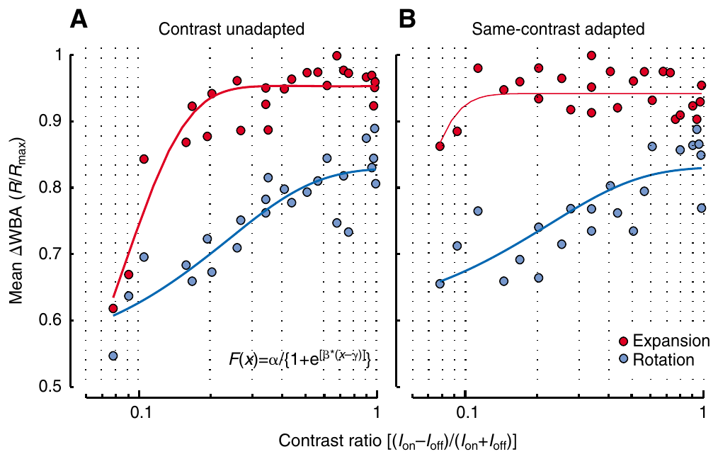
Contrast changes the strength of optomotor turning
Contrast quantifies the difference between bright and dark pattern regions relative to their combined intensity. Duistermars and colleagues varied contrast while holding wavelength at 30° and speed at 232°/s, separating pattern visibility from changes in its motion.
Before an unadapted test, the fly controlled a single stripe. Before an adapted test, it experienced the wide-field test contrast for 7 s. Thus the comparison changed recent visual exposure without changing the subsequent moving pattern.
Expansion steering saturated at lower contrasts than rotational steering in the unadapted condition. Prior contrast exposure altered sensitivity and made the response relationships more nearly linear. Behavioral gain, the response change per stimulus change, depends on recent stimulation as well as motion direction.
Duistermars et al. (2007), Fig. 7. Prior contrast exposure changes steering sensitivity.
Duistermars et al. (2007)
05
Notes:
• Contrast changes the strength of retinal intensity modulation even when stripe spacing and speed remain fixed. The experiment used multiple contrast values and randomized their order, so a difference in steering did not simply reflect increasing contrast through the session.
• The adaptation manipulation placed the animal in the same wide-field contrast before testing it. Seven seconds of prior exposure changed the history of the visual pathway while preserving the properties of the test stimulus.
• Expansion and rotation differed in how rapidly steering approached saturation. The result concerns the complete sensorimotor pathway: it does not localize contrast adaptation to a particular photoreceptor, interneuron or motor neuron.
References:
Duistermars BJ, Chow DM, Condro M, Frye MA (2007). The spatial, temporal and contrast properties of expansion and rotation flight optomotor responses in Drosophila. Journal of Experimental Biology 210:3218-3227. https://doi.org/10.1242/jeb.007807
Figure: Duistermars et al. (2007), Fig. 7. Prior contrast exposure changes steering sensitivity.
Figure source: https://doi.org/10.1242/jeb.007807

Slide 7
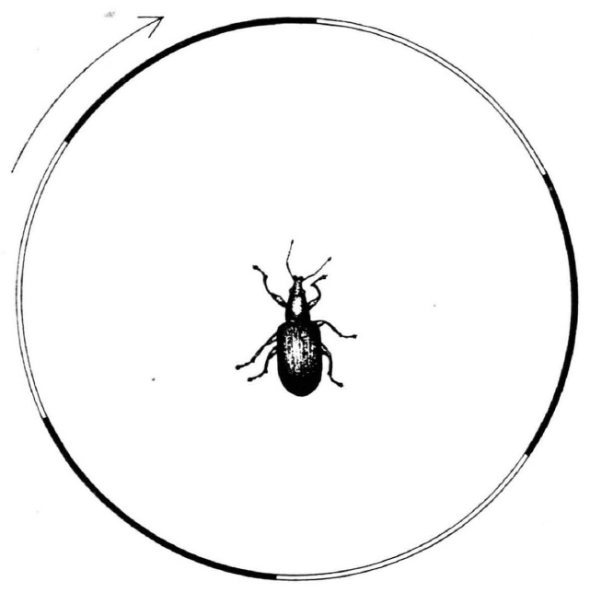
Reichardt's original experiments used a beetle
Hassenstein and Reichardt developed their motion-detection account from the weevil Chlorophanus, not from Drosophila. A striped rotating surround elicited a compensatory turning response, linking the sequence of visual stimulation to a directional behavioral output.
Their 1956 analysis separated the timing, order and sign of local brightness changes. A motion signal required a relationship between neighboring visual inputs: a single location changing brightness did not uniquely specify which direction an object traveled.
The elementary motion detector is a local computation comparing signals from different visual positions over time. Its historical derivation described operations sufficient to explain behavior. Later fly experiments tested that computation and traced it to identified cells, T4 and T5 among them.
Hassenstein & Reichardt (1956), Fig. 2. A beetle inside the original rotating striped drum.
Hassenstein & Reichardt (1956); Clark et al. (2011)
06
Notes:
• The original animal was a weevil. Hassenstein and Reichardt related compensatory behavior to carefully controlled sequences of local stimulation, rather than reconstructing a fly circuit.
• A luminance change at one location is compatible with several causes, including an object entering, an object leaving or a light source changing intensity. Direction becomes available when responses at different positions are compared in a time-dependent way.
• Elementary means local here: the computation concerns neighboring visual inputs rather than a whole panoramic flow field. The operations inferred from beetle behavior and the cell types subsequently measured in fruit flies are different levels of explanation and different experimental preparations.
References:
Hassenstein B, Reichardt W (1956). Systemtheoretische Analyse der Zeit-, Reihenfolgen- und Vorzeichenauswertung bei der Bewegungsperzeption des Rüsselkäfers Chlorophanus. Zeitschrift für Naturforschung B 11:513–524. https://doi.org/10.1515/znb-1956-9-1004
Clark DA, Bursztyn L, Horowitz MA, Schnitzer MJ, Clandinin TR (2011). Defining the computational structure of the motion detector in Drosophila. Neuron 70:1165-1177. https://doi.org/10.1016/j.neuron.2011.05.023
Figure: Hassenstein & Reichardt (1956), Fig. 2. A beetle inside the original rotating striped drum.
Figure source: https://doi.org/10.1515/znb-1956-9-1004

Slide 8
A single brightness change is ambiguous about direction
A change in brightness at one location has several possible causes: an object entering the location, an object leaving it, or a light source changing intensity. The signal from that location alone therefore does not specify which way anything moved.
Hassenstein and Reichardt analyzed the weevil's turning response in terms of the timing, order and sign of brightness changes at neighboring positions. Direction becomes available when the responses at two positions are compared in a time-dependent way, because the order in which the positions change carries the direction.
Elementary means local here: the comparison concerns two neighboring visual inputs rather than a whole panoramic flow field. The operations inferred from the beetle behavior and the cell types later measured in fruit flies are different levels of explanation of one computation.
Hassenstein & Reichardt (1956), Fig. 2. A beetle inside the original rotating striped drum.
Hassenstein & Reichardt (1956); Clark et al. (2011)
06a
Notes:
• Direction is a relationship between two places and two times, which a single photoreceptor signal cannot supply.
• One location is not enough.
– A brightening at a point fits an approaching bright object, a retreating dark object or a lamp turning up, so its direction is undetermined.
– Comparing the point with its neighbor adds the missing information, because the order of the two changes distinguishes left-to-right from right-to-left motion.
• What the 1956 analysis separated.
– Hassenstein and Reichardt distinguished the timing, order and sign of local brightness changes in the beetle's behavior.
– Those operations were sufficient to explain the turning response and defined what the later fly experiments tested.
• Local computation, wide-field behavior.
– Elementary means the computation concerns neighboring inputs, whereas the optomotor turn on slide 2 is a response to a rotating panorama.
– The beetle analysis specifies the operations, and the fly experiments identify neurons such as T4 and T5 that carry them out.
References:
Hassenstein B, Reichardt W (1956). Systemtheoretische Analyse der Zeit-, Reihenfolgen- und Vorzeichenauswertung bei der Bewegungsperzeption des Rüsselkäfers Chlorophanus. Zeitschrift für Naturforschung B 11:513–524. https://doi.org/10.1515/znb-1956-9-1004
Clark DA, Bursztyn L, Horowitz MA, Schnitzer MJ, Clandinin TR (2011). Defining the computational structure of the motion detector in Drosophila. Neuron 70:1165-1177. https://doi.org/10.1016/j.neuron.2011.05.023

Slide 9
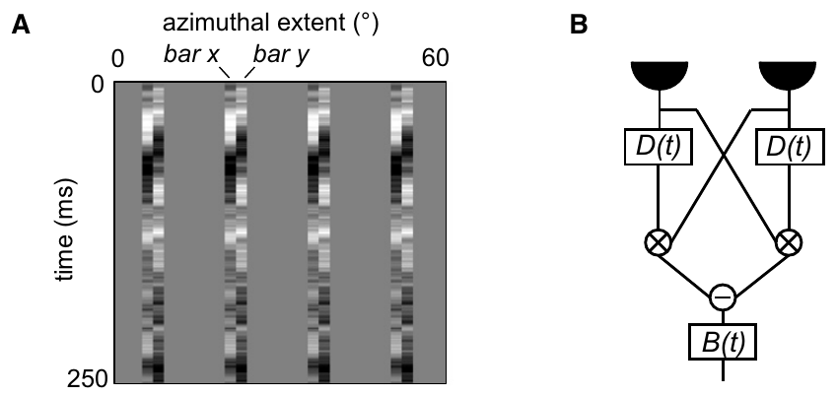
Sequential stimulation supplies directional information
Apparent motion can arise when adjacent visual positions are stimulated successively, even without a continuously moving object. Reversing the order of stimulation changes the available direction cue while leaving the individual locations unchanged.
Clark and colleagues presented independently varying pairs of 2°-wide bars to flies walking on a ball. The repeated bar pairs supplied local intensity sequences without requiring the experimenter to assign a coherent moving feature to every frame.
Turning was related to correlations between neighboring bar intensities separated by approximately 20–30 ms. A correlation here means a joint dependence on the two signals. The timing relationship supports a delayed interaction, rather than a detector responding only to the intensity at one location.
Clark et al. (2011), Fig. 2(A, B). Independent neighboring bars probe a delayed interaction.
Clark et al. (2011); Hassenstein & Reichardt (1956)
07
Notes:
• A pair of neighboring locations can carry a direction cue through their order of activation. Continuous movement is unnecessary when the sequence itself supplies the relevant spatial and temporal relationship.
• The randomly changing bar pairs were useful because each input varied independently. A relationship between turning and the joint input could then be separated from a relationship between turning and either input alone.
• The behavioral analysis identified an effective delay of about twenty to thirty milliseconds. This is a fitted temporal relationship in a sensorimotor response, rather than a measurement of one receptor's kinetics or a direct recording of a named delay neuron.
References:
Clark DA, Bursztyn L, Horowitz MA, Schnitzer MJ, Clandinin TR (2011). Defining the computational structure of the motion detector in Drosophila. Neuron 70:1165-1177. https://doi.org/10.1016/j.neuron.2011.05.023
Hassenstein B, Reichardt W (1956). Systemtheoretische Analyse der Zeit-, Reihenfolgen- und Vorzeichenauswertung bei der Bewegungsperzeption des Rüsselkäfers Chlorophanus. Zeitschrift für Naturforschung B 11:513–524. https://doi.org/10.1515/znb-1956-9-1004
Figure: Clark et al. (2011), Fig. 2(A, B). Independent neighboring bars probe a delayed interaction.
Figure source: https://doi.org/10.1016/j.neuron.2011.05.023

Slide 10
A delayed interaction compares neighboring signals
The Hassenstein–Reichardt correlator compares two neighboring inputs after applying different temporal filtering to them. One signal is delayed relative to the other, allowing a moving pattern's sequential activation to overlap within the computation.
The delayed and less-delayed signals interact multiplicatively: their joint contribution depends on both inputs, rather than their simple sum. A mirror-symmetric arm reverses which spatial input is delayed, and the two arm outputs are subtracted.
Clark's random-bar experiments supported this correlation structure in fly turning, with a fitted delay filter peaking near 25 ms. That delay summarizes the combined effect of synaptic kinetics, membrane filtering and circuit connections, any of which can supply the temporal offset between the two inputs.
Clark et al. (2011), Fig. 2(A, B). The published correlation detector and its visual inputs.
Hassenstein & Reichardt (1956); Clark et al. (2011)
08
Notes:
• Temporal filtering means that an input's contribution depends on its recent history. The two inputs do not need to arrive with the same time course, and motion can bring the less-delayed input into correspondence with the retained earlier input.
• Multiplication makes the interaction sensitive to the presence and sign of both signals. The mirror arm has the opposite spatial arrangement, so subtracting the two arms creates a signed response that distinguishes the two directions.
• The effective twenty-five-millisecond delay was inferred by fitting behavior. The same computation could arise from several combinations of synaptic kinetics, membrane filtering and circuit connections, so the fit does not establish a unique biophysical implementation.
References:
Hassenstein B, Reichardt W (1956). Systemtheoretische Analyse der Zeit-, Reihenfolgen- und Vorzeichenauswertung bei der Bewegungsperzeption des Rüsselkäfers Chlorophanus. Zeitschrift für Naturforschung B 11:513–524. https://doi.org/10.1515/znb-1956-9-1004
Clark DA, Bursztyn L, Horowitz MA, Schnitzer MJ, Clandinin TR (2011). Defining the computational structure of the motion detector in Drosophila. Neuron 70:1165-1177. https://doi.org/10.1016/j.neuron.2011.05.023
Figure: Clark et al. (2011), Fig. 2(A, B). The published correlation detector and its visual inputs.
Figure source: https://doi.org/10.1016/j.neuron.2011.05.023

Slide 11
The detector turns a sequence into a signed output
The Hassenstein–Reichardt detector processes two neighboring inputs in four steps. One input is delayed relative to the other, the delayed signal is multiplied by the less-delayed signal from the neighboring position, a mirror-symmetric arm repeats the operation with the delay on the opposite input, and the outputs of the two arms are subtracted.
Delay keeps an earlier input available until the later input arrives. A moving pattern that stimulates the two positions in the preferred order brings the delayed and less-delayed signals into overlap, so the multiplied product is large in the arm matched to that order.
The mirror arm has the opposite spatial arrangement, so reversing the direction of motion exchanges the contributions of the two arms. Subtracting them gives a signed output that distinguishes the two directions, whereas adding them would discard much of the directional distinction.
Clark et al. (2011), Fig. 2(A, B). The published correlation detector and its visual inputs.
Hassenstein & Reichardt (1956); Clark et al. (2011)
08a
Notes:
• The detector is a four-step computation on two neighboring inputs, and each step has a specific job.
• Temporal filtering sets up the delay.
– An input's contribution depends on its recent history, so one signal can be retained while the other arrives.
– The two inputs need not have the same time course.
• Multiplication makes the interaction depend on both signals.
– The product is sensitive to the presence and sign of both inputs, so it responds when the retained signal and the neighboring signal coincide.
• The mirror arm and subtraction make the output directional.
– The second arm swaps which spatial input is delayed.
– Subtracting the arms creates a signed response, which is what distinguishes the two directions of motion.
• The 25 ms value is a fitted delay.
– Clark and colleagues inferred it from turning behavior, and the same computation could arise from several combinations of synaptic kinetics, membrane filtering and circuit connections.
References:
Hassenstein B, Reichardt W (1956). Systemtheoretische Analyse der Zeit-, Reihenfolgen- und Vorzeichenauswertung bei der Bewegungsperzeption des Rüsselkäfers Chlorophanus. Zeitschrift für Naturforschung B 11:513–524. https://doi.org/10.1515/znb-1956-9-1004
Clark DA, Bursztyn L, Horowitz MA, Schnitzer MJ, Clandinin TR (2011). Defining the computational structure of the motion detector in Drosophila. Neuron 70:1165-1177. https://doi.org/10.1016/j.neuron.2011.05.023

Slide 12
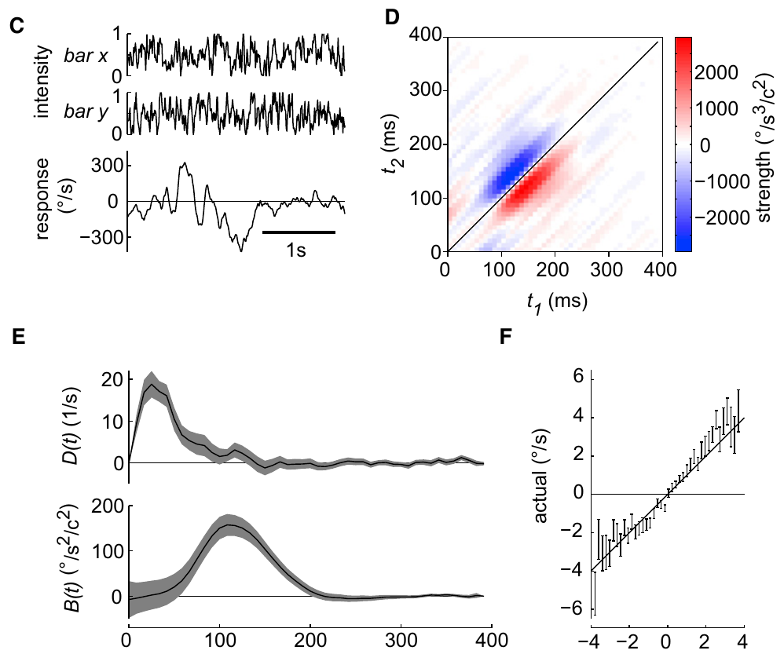
Opponent detector arms distinguish motion direction
An opponent computation subtracts signals favoring opposite alternatives. In the Reichardt detector, the two arms exchange the positions receiving the relative delay. Direction is encoded by their imbalance, rather than by the activity of either arm alone.
Clark and colleagues fitted a two-dimensional temporal kernel, a weighting of earlier input combinations that predicted turning. Neighboring intensities contributed most strongly when separated by 20–30 ms, and the relationship between predicted and measured mean turning was approximately linear.
The weak random-bar stimulus produced substantial turning unrelated to the stimulus, so the fit accounted for only a small fraction of the trial-by-trial variability. What it captured was the average directional interaction, with predicted and measured mean turning related approximately linearly.
Clark et al. (2011), Fig. 2(C, D, E, F). Measured temporal kernel and predicted versus actual turning.
Clark et al. (2011)
09
Notes:
• Opponent subtraction gives the computation a sign. Reversing the spatial sequence exchanges the contributions of the two arms, whereas adding them would discard much of the directional distinction.
• A temporal kernel specifies which combinations of past inputs contribute to a measured response. The investigators also included a behavioral filter, because the motor output has dynamics beyond those of the local detector.
• A model can capture the average relationship while predicting little of the moment-to-moment variation. The weak stimulus produced substantial stimulus-independent turning, so a successful mean fit should not be interpreted as a complete explanation of every turn.
References:
Clark DA, Bursztyn L, Horowitz MA, Schnitzer MJ, Clandinin TR (2011). Defining the computational structure of the motion detector in Drosophila. Neuron 70:1165-1177. https://doi.org/10.1016/j.neuron.2011.05.023
Figure: Clark et al. (2011), Fig. 2(C, D, E, F). Measured temporal kernel and predicted versus actual turning.
Figure source: https://doi.org/10.1016/j.neuron.2011.05.023

Slide 13
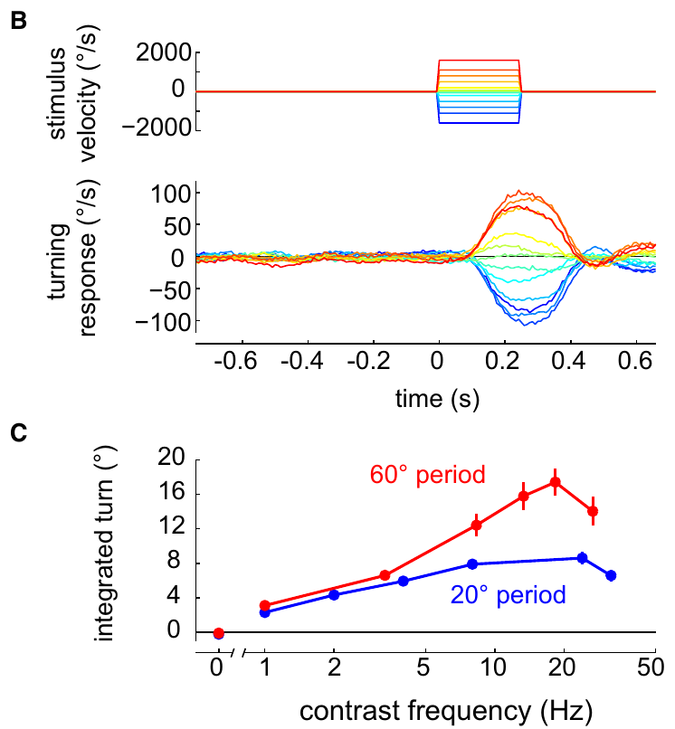
Correlation detectors do not measure velocity alone
An angular velocity reports how many degrees a pattern moves per second. A correlation detector's response also depends on spatial structure and temporal filtering, so it is not a pattern-independent speedometer.
Clark and colleagues measured turning responses to gratings with 20° and 60° spatial periods across multiple temporal frequencies. Turning increased and then declined as temporal frequency rose. Duistermars obtained a comparable band of effective temporal frequencies during tethered flight.
Changing wavelength changes the time between neighboring contrast events at a fixed speed. A detector can therefore respond differently to two patterns moving at the same velocity. The measured tuning curve reflects the whole pathway, with spatial pooling, adaptation and the dynamics of the motor response shaping it alongside the local detector.
Clark et al. (2011), Fig. 1(B, C). Grating spacing changes the relationship between speed and turning.
Clark et al. (2011); Duistermars et al. (2007)
10
Notes:
• Velocity and temporal frequency are related through stripe spacing. A given angular speed can produce rapid local modulation for narrow stripes and slower modulation for broad stripes.
• The walking and flight experiments both obtained tuning rather than a response that simply increased across all speeds. Very rapid repetition eventually became less effective, consistent with the finite temporal resolution of the pathway.
• These measurements concern a complete behavioral response. The fitted tuning cannot be attributed entirely to one delay element because the animal's optics, multiple neural stages and steering machinery all contribute to the measured curve.
References:
Clark DA, Bursztyn L, Horowitz MA, Schnitzer MJ, Clandinin TR (2011). Defining the computational structure of the motion detector in Drosophila. Neuron 70:1165-1177. https://doi.org/10.1016/j.neuron.2011.05.023
Duistermars BJ, Chow DM, Condro M, Frye MA (2007). The spatial, temporal and contrast properties of expansion and rotation flight optomotor responses in Drosophila. Journal of Experimental Biology 210:3218-3227. https://doi.org/10.1242/jeb.007807
Figure: Clark et al. (2011), Fig. 1(B, C). Grating spacing changes the relationship between speed and turning.
Figure source: https://doi.org/10.1016/j.neuron.2011.05.023

Slide 14
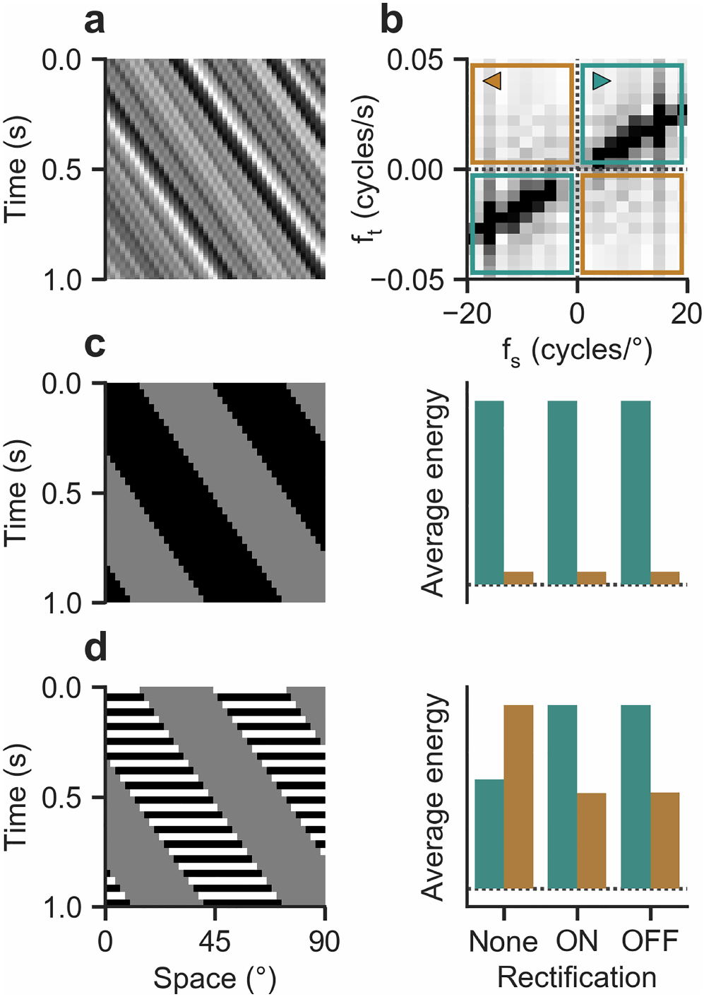
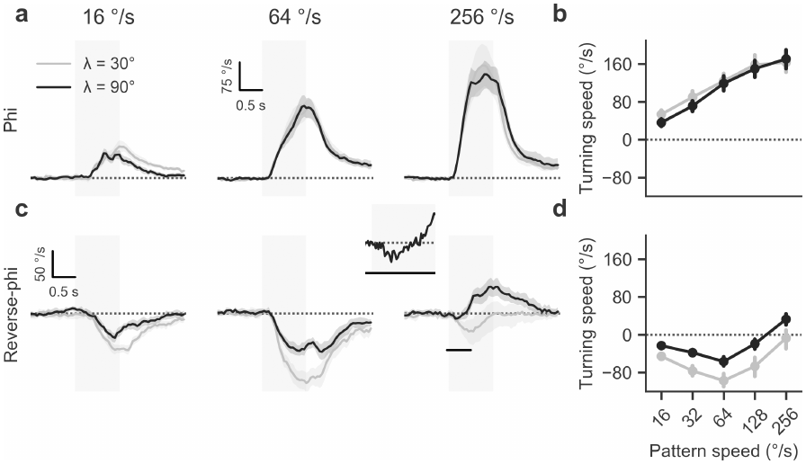
Contrast reversals can reverse perceived motion
In phi motion, a pattern shifts between frames while preserving its contrast. In reverse-phi motion, each shift also reverses bright and dark regions. Physical displacement and the direction signaled by the visual system can then disagree.
Leonhardt and colleagues measured tethered walking during discrete pattern shifts. Ordinary phi elicited turning with the pattern. Reverse-phi elicited turning against it at lower velocities, while sufficiently rapid stimulation could reverse the behavioral response again.
Contrast inversion changes the sign of interactions between neighboring signals in a correlation computation. Reverse-phi therefore probes the detector's operations, rather than simply testing whether the fly can track an identifiable object. At high velocities the turning becomes aligned with the displacement again, so the response depends on stimulus speed as well as on contrast sign.
Leonhardt et al. (2017), Fig. 2(a–f). Contrast-preserving and contrast-reversing apparent-motion stimuli.
Leonhardt et al. (2017), Fig. 3. Measured turning reverses under reverse-phi stimulation.
Leonhardt et al. (2017)
11
Notes:
• The spatial displacement is the same type of event in both conditions. What changes is whether a bright region remains bright after the step or becomes dark. That additional contrast reversal can alter the sign of the motion computation.
• Flies turned against slower reverse-phi patterns, but at high velocities their turning could become aligned with displacement again. The response cannot be described adequately by a rule that every reverse-phi stimulus produces an opposite turn.
• The experiment separates a feature's physical displacement from the signed response of the visual pathway. It supplies a demanding test for models of motion detection because a model must account for both the ordinary response and the stimulus-dependent illusion.
References:
Leonhardt A, Meier M, Serbe E, Eichner H, Borst A (2017). Neural mechanisms underlying sensitivity to reverse-phi motion in the fly. PLoS ONE 12:e0189019. https://doi.org/10.1371/journal.pone.0189019
Figure: Leonhardt et al. (2017), Fig. 2(a–f). Contrast-preserving and contrast-reversing apparent-motion stimuli.
Figure source: https://doi.org/10.1371/journal.pone.0189019
Figure: Leonhardt et al. (2017), Fig. 3. Measured turning reverses under reverse-phi stimulation.
Figure source: https://doi.org/10.1371/journal.pone.0189019

Slide 15
Contrast reversal flips the sign of the product
In phi motion a pattern shifts between frames and keeps its contrast; in reverse-phi motion each shift also swaps bright and dark regions. The physical displacement is the same in both cases, but the brightness change at each position has the opposite sign in reverse-phi.
A correlation detector multiplies signals from neighboring positions, and a product is sensitive to the sign of both inputs. When a bright region is followed at the neighboring position by a dark one, the two signals have opposite signs, so the sign of the product reverses and the detector reports motion opposite to the displacement.
Flies turned against slower reverse-phi patterns, as this account predicts. At high velocities their turning became aligned with the displacement again, so a model of the detector has to account for both the ordinary response and the stimulus-dependent illusion.
Leonhardt et al. (2017), Fig. 2(a–f). Contrast-preserving and contrast-reversing apparent-motion stimuli.
Leonhardt et al. (2017), Fig. 3. Measured turning reverses under reverse-phi stimulation.
Leonhardt et al. (2017)
11a
Notes:
• Reverse-phi separates the physical displacement of a feature from the direction signaled by the visual pathway.
• Two stimuli share one displacement.
– In phi motion a bright feature stays bright after the step; in reverse-phi it becomes dark.
– The step is the same kind of spatial event, so the difference between the conditions lies in the sign of the contrast change.
• The multiplication step carries the sign.
– A multiplier responds to the sign of both of its inputs, as described on slide 8.
– Opposite-sign inputs from two neighboring positions therefore produce a negative contribution where same-sign inputs produce a positive one.
• Speed adds a second dependence.
– Flies turned against slower reverse-phi patterns, but at high velocities their turning could become aligned with displacement again.
– The turning direction depends on velocity as well as contrast sign, which makes the illusion a demanding test of detector models.
• Why the illusion tests models.
– A model has to reproduce the ordinary response to phi motion and the reversed response to reverse-phi motion with one set of operations.
– The velocity dependence adds a further constraint, because the same model must also explain why fast reverse-phi turning returns to the direction of the displacement.
– The experiment therefore separates a feature's physical displacement from the signed response of the visual pathway.
References:
Leonhardt A, Meier M, Serbe E, Eichner H, Borst A (2017). Neural mechanisms underlying sensitivity to reverse-phi motion in the fly. PLoS ONE 12:e0189019. https://doi.org/10.1371/journal.pone.0189019

Slide 16
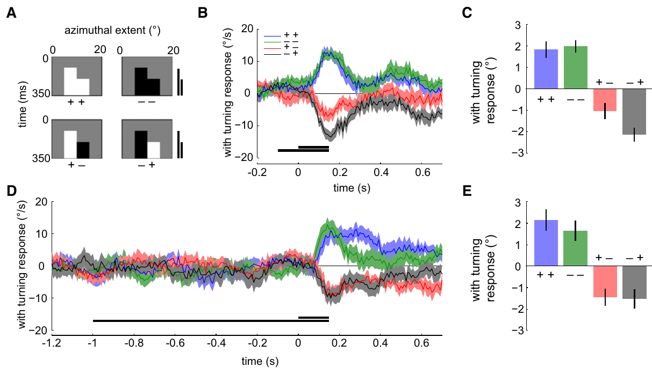
Contrast-polarity tests constrain detector architecture
A contrast polarity specifies whether local brightness increases or decreases relative to a reference. Two successive neighboring events can therefore form four pairings: bright–bright, dark–dark, bright–dark and dark–bright.
Clark and colleagues presented minimal sequential bar pairs while recording ball-based turning. Flies responded to all four pairings. Contrast-preserving sequences favored one directional sign; contrast-reversing sequences favored the opposite sign under the tested timing conditions.
These results constrain how ON and OFF pathways can implement the correlation computation. Even with bright and dark events processed in separate pathways, the behavior requires effective sensitivity to opposite-polarity events, which could come from baseline activity, inhibition or another circuit operation.
Clark et al. (2011), Fig. 6. All four contrast-pair sequences influence fly turning.
Clark et al. (2011)
12
Notes:
• The four pairings exhaust the signs of two local brightness changes. They distinguish computations that correlate same-polarity signals from computations that are also sensitive to opposite-polarity relationships.
• The minimal stimuli were controlled sequences of neighboring bars. Changing the polarity combination changed the direction of the response while preserving the basic two-location arrangement.
• Separate pathways can have preferences without becoming completely independent of the other polarity. The behavioral data require effective sensitivity to opposite-sign events, but they do not specify whether that sensitivity arises from baseline activity, inhibition or another circuit operation.
References:
Clark DA, Bursztyn L, Horowitz MA, Schnitzer MJ, Clandinin TR (2011). Defining the computational structure of the motion detector in Drosophila. Neuron 70:1165-1177. https://doi.org/10.1016/j.neuron.2011.05.023
Figure: Clark et al. (2011), Fig. 6. All four contrast-pair sequences influence fly turning.
Figure source: https://doi.org/10.1016/j.neuron.2011.05.023

Slide 17
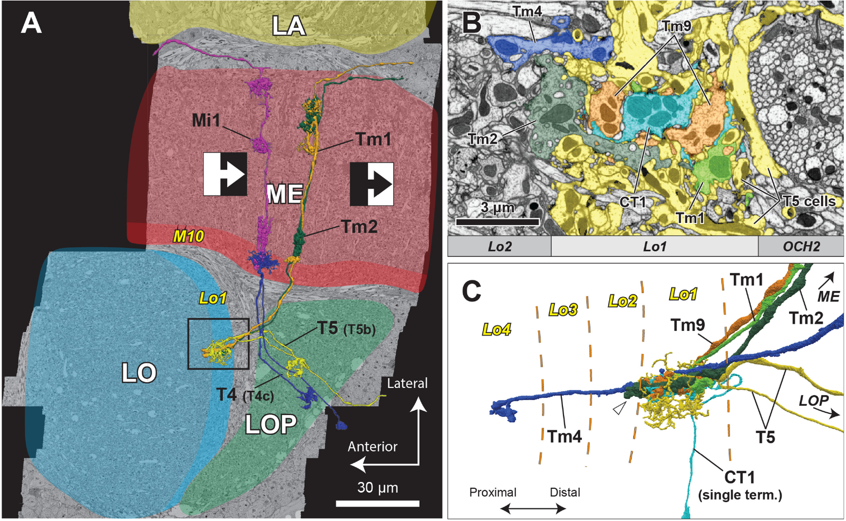
The fly optic lobe preserves visual position
The optic lobe contains successive visual processing regions beside the central brain. A neuropil is a region rich in neuronal processes and synapses. The fly's major optic neuropils are the lamina, medulla, lobula and lobula plate.
Retinotopy preserves the neighborhood relationships of visual positions within neural tissue. Repeated columns carry signals associated with neighboring locations, so local motion can be computed by comparing inputs from adjacent columns rather than losing spatial identity immediately.
Shinomiya and colleagues reconstructed neurons and synapses with focused-ion-beam scanning electron microscopy. T4 dendrites occupy medulla layer M10, whereas T5 dendrites occupy lobula layer Lo1. Their axons converge in the lobula plate, so two anatomically separate input routes feed a common output neuropil.
Shinomiya et al. (2019), Fig. 1. Reconstructed neurons traverse the optic-lobe neuropils.
Takemura et al. (2017); Shinomiya et al. (2019)
13
Notes:
• Neuropils contain the branching processes where visual neurons communicate. The lamina is the first optic neuropil, followed by deeper processing in the medulla and lobula complex.
• Retinotopy means that neighboring locations in visual space remain neighbors in the neural representation. Repeated columns preserve enough spatial organization for a neuron to compare signals displaced across the visual field.
• Electron microscopy traced the two motion pathways through different dendritic compartments. T4 receives inputs in M10 and T5 in Lo1, while both send output to the lobula plate. The reconstruction identifies connections and spatial arrangement; physiological measurements are required to determine filtering and response sign.
References:
Takemura SY, Nern A, Chklovskii DB, Scheffer LK, Rubin GM, Meinertzhagen IA (2017). The comprehensive connectome of a neural substrate for 'ON' motion detection in Drosophila. eLife 6:e24394. https://doi.org/10.7554/elife.24394
Shinomiya K, Huang G, Lu Z, Parag T, Xu CS, Aniceto R, Ansari N, Cheatham N, Lauchie S, Neace E, Ogundeyi O, Ordish C, Peel D, Shinomiya A, Smith C, Takemura S, Talebi I, Rivlin PK, Nern A, Scheffer LK, Plaza SM, Meinertzhagen IA (2019). Comparisons between the ON- and OFF-edge motion pathways in the Drosophila brain. eLife 8:e40025. https://doi.org/10.7554/elife.40025
Figure: Shinomiya et al. (2019), Fig. 1. Reconstructed neurons traverse the optic-lobe neuropils.
Figure source: https://doi.org/10.7554/elife.40025

Slide 18
Retinotopic columns let neighboring signals be compared
Retinotopy means that neighboring locations in visual space remain neighbors in the neural representation. In the fly optic lobe, repeated columns carry signals from neighboring locations, so a neuron can compare inputs from adjacent columns instead of losing spatial identity at the first synapse.
The visual signal passes through successive neuropils: the lamina, the medulla, the lobula and the lobula plate. A neuropil is a region rich in neuronal processes and synapses, and the columnar layout carries visual position through these stages.
T4 dendrites receive their inputs in medulla layer M10 and T5 dendrites in lobula layer Lo1, and both send axons to the lobula plate. Two input routes with different relay neurons therefore end in one output neuropil.
Shinomiya et al. (2019), Fig. 1. Reconstructed neurons traverse the optic-lobe neuropils.
Shinomiya et al. (2019); Takemura et al. (2017)
13a
Notes:
• A motion computation needs signals from different visual positions to be available side by side, and retinotopic organization supplies them.
• What retinotopy preserves.
– Neighbors in the visual field remain neighbors in the neural tissue.
– Repeated columns therefore provide the spatial arrangement that a neuron needs to compare signals displaced across the visual field.
• The route through the optic lobe.
– The lamina is the first optic neuropil, followed by the medulla and the lobula complex, which includes the lobula and the lobula plate.
– T4 receives inputs in medulla layer M10 and T5 in lobula layer Lo1, while both send their output to the lobula plate.
• Connections come from electron microscopy.
– Shinomiya and colleagues reconstructed neurons and synapses with focused-ion-beam scanning electron microscopy, which identifies where each pathway receives its input.
– Filtering and response sign come from physiological measurements.
• Why two routes matter for a motion computation.
– T4 and T5 receive different relay neurons, so the ON and OFF pathways reach the same output neuropil by separate input populations.
– Within each pathway, the columnar arrangement keeps the spatial order of the inputs, which is the arrangement a comparison between neighboring positions depends on.
References:
Shinomiya K, Huang G, Lu Z, Parag T, Xu CS, Aniceto R, Ansari N, Cheatham N, Lauchie S, Neace E, Ogundeyi O, Ordish C, Peel D, Shinomiya A, Smith C, Takemura S, Talebi I, Rivlin PK, Nern A, Scheffer LK, Plaza SM, Meinertzhagen IA (2019). Comparisons between the ON- and OFF-edge motion pathways in the Drosophila brain. eLife 8:e40025. https://doi.org/10.7554/elife.40025
Takemura SY, Nern A, Chklovskii DB, Scheffer LK, Rubin GM, Meinertzhagen IA (2017). The comprehensive connectome of a neural substrate for 'ON' motion detection in Drosophila. eLife 6:e24394. https://doi.org/10.7554/elife.24394

Slide 19
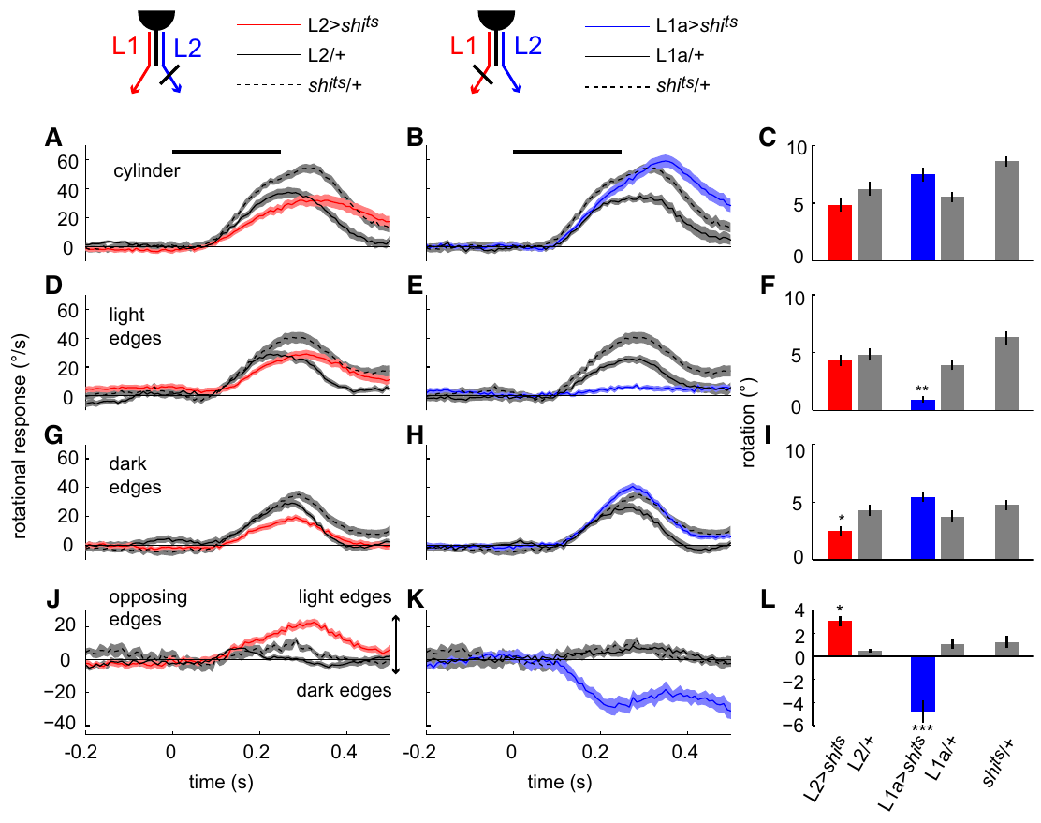
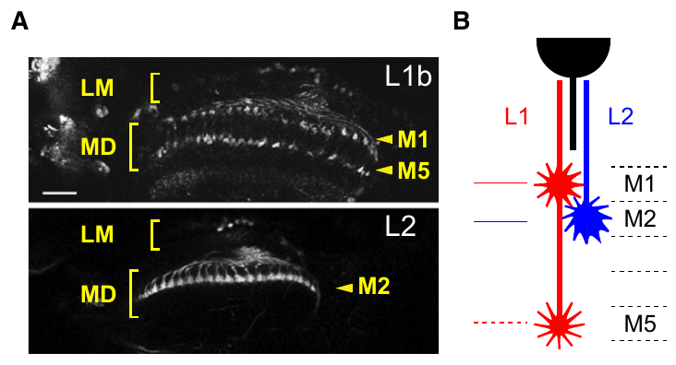
Lamina pathways divide luminance-change signals
Luminance is the light intensity represented at a visual location. Lamina neurons L1 and L2 relay signals from the outer photoreceptors R1–R6 into the medulla. Their axon terminals occupy different medulla layers. Photoreceptor histamine, a neurotransmitter, activates chloride channels in L1/L2 and inverts the light response: increased brightness reduces terminal calcium.
Clark and colleagues used shibire, a temperature-sensitive interference with synaptic vesicle recycling, to suppress output from selected neurons. They compared experimental flies with driver-only and effector-only controls while presenting isolated light edges, dark edges or opposing edges.
L1-associated processing favored light-edge motion, whereas L2-associated processing favored dark-edge motion. Both pathways retained overlapping sensitivity, and their light-evoked terminal calcium responses were similar at the relay stage, so the edge preferences are not simply a consequence of L1 and L2 responding to light with opposite signs.
Clark et al. (2011), Fig. 4(A, B). L1/L2 terminals.
Clark et al. (2011), Fig. 3. Silencing L1 or L2 changes edge-polarity steering.
Clark et al. (2011); Takemura et al. (2017)
14
Notes:
• L1 and L2 are relay neurons between the photoreceptors and medulla circuits. Their terminal locations differ, so the same visual position can supply distinct downstream pathways. Histamine-gated chloride channels invert the photoreceptor signal, consistent with decreased L1 and L2 terminal calcium when brightness increases.
• The temperature-sensitive shibire manipulation reduces synaptic output rather than removing the neuron. Genetic controls are necessary because temperature, driver expression and the effector construct can influence behavior independently of the intended block.
• Isolated-edge stimuli separated preferences that would be hidden in a conventional grating containing both light and dark edges. The L1 route favored bright-edge motion and the L2 route favored dark-edge motion, but the investigators measured overlapping sensitivity and similar light-evoked calcium responses at the relay stage.
References:
Clark DA, Bursztyn L, Horowitz MA, Schnitzer MJ, Clandinin TR (2011). Defining the computational structure of the motion detector in Drosophila. Neuron 70:1165-1177. https://doi.org/10.1016/j.neuron.2011.05.023
Takemura SY, Nern A, Chklovskii DB, Scheffer LK, Rubin GM, Meinertzhagen IA (2017). The comprehensive connectome of a neural substrate for 'ON' motion detection in Drosophila. eLife 6:e24394. https://doi.org/10.7554/elife.24394
Figure: Clark et al. (2011), Fig. 3. Silencing L1 or L2 changes edge-polarity steering.
Figure source: https://doi.org/10.1016/j.neuron.2011.05.023
Figure: Clark et al. (2011), Fig. 4(A, B). L1/L2 terminals.
Figure source: https://doi.org/10.1016/j.neuron.2011.05.023

Slide 20
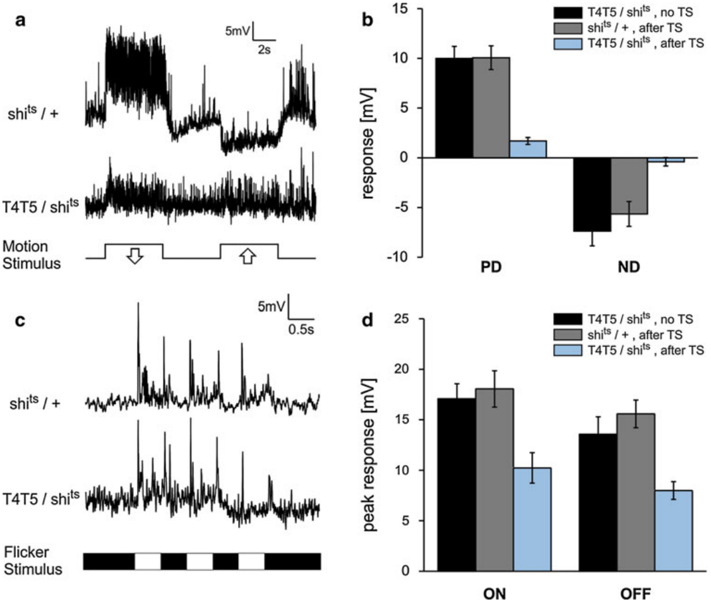
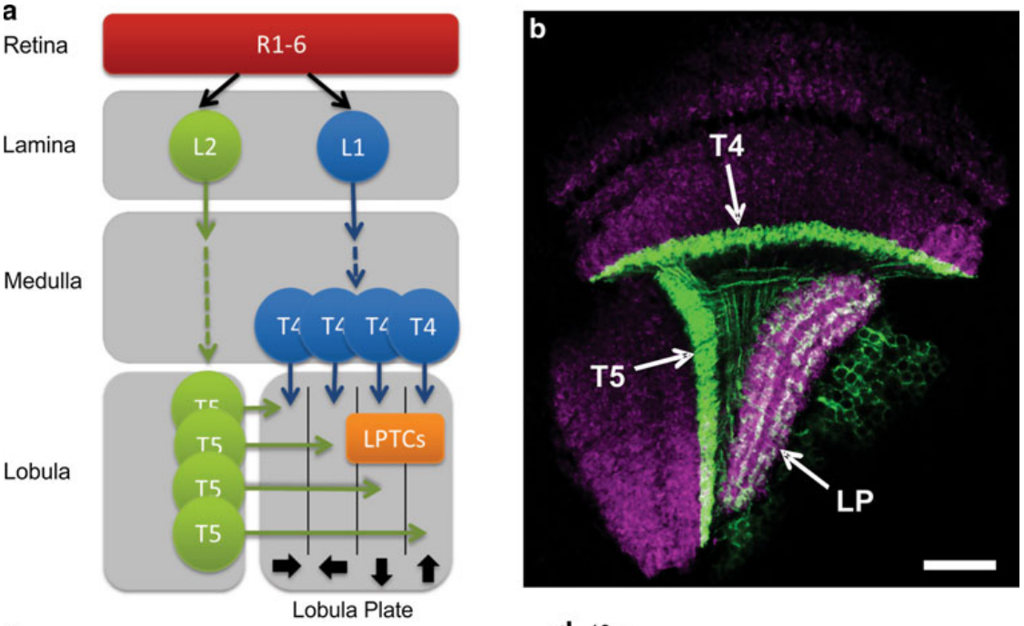
T4 and T5 provide local direction-selective signals
T4 and T5 are repeated small-field neurons linking earlier visual pathways to the lobula plate. A direction-selective neuron responds differently to opposite motion directions through the same region of visual space. T4 and T5 supply direction-selective signals to larger visual interneurons.
Schnell and colleagues recorded membrane voltage from lobula plate tangential cells while suppressing T4/T5 output with temperature-sensitive shibire. A tangential cell extends processes across many visual columns, allowing comparison between a local input population and a wide-field response.
Motion-evoked depolarization and hyperpolarization were largely abolished during the block, whereas flicker responses remained. A flicker changes brightness without ordered spatial displacement. The selective loss supports a necessary motion input from T4/T5 rather than complete failure of the recorded neuron.
Schnell et al. (2012), Fig. 1(a, b). T4/T5 anatomy.
Schnell et al. (2012), Fig. 2(a–d). Motion responses disappear while flicker responses persist.
Schnell et al. (2012)
15
Notes:
• T4 and T5 repeat across the visual field, and each neuron samples a relatively small region. Tangential cells receive from many such local detectors and therefore respond to much larger patterns.
• Membrane voltage was recorded directly while the experimenter blocked T4/T5 synaptic output. The important comparison is between motion and flicker in the same pathway, rather than between different animals responding to unrelated tasks.
• The persistence of flicker responses means that the tangential cells were still capable of responding to visual stimulation. Their loss of directional motion responses specifically implicates T4/T5 transmission, although this manipulation blocks the two cell classes together and does not assign a separate role to each.
References:
Schnell B, Raghu SV, Nern A, Borst A (2012). Columnar cells necessary for motion responses of wide-field visual interneurons in Drosophila. Journal of Comparative Physiology A 198:389-395. https://doi.org/10.1007/s00359-012-0716-3
Figure: Schnell et al. (2012), Fig. 2(a–d). Motion responses disappear while flicker responses persist.
Figure source: https://doi.org/10.1007/s00359-012-0716-3
Figure: Schnell et al. (2012), Fig. 1(a, b). T4/T5 anatomy.
Figure source: https://doi.org/10.1007/s00359-012-0716-3

Slide 21
A silenced output differs from a failed cell
Temperature-sensitive shibire interferes with synaptic vesicle recycling, so raising the temperature reduces the synaptic output of selected neurons without removing the cells. Because temperature, driver expression and the effector construct can each influence behavior or physiology, experimental flies are compared with driver-only and effector-only controls.
Schnell and colleagues recorded membrane voltage from lobula plate tangential cells while blocking T4/T5 output. Motion-evoked depolarization and hyperpolarization were largely abolished, whereas responses to flicker, a brightness change without ordered spatial displacement, remained.
Retained flicker responses show that the recorded cell could still receive and respond to visual input, so the loss of directional responses implicates T4/T5 transmission specifically. The block silences the two classes together, which establishes the pair as a necessary motion input.
Schnell et al. (2012), Fig. 1(a, b). T4/T5 anatomy.
Schnell et al. (2012), Fig. 2(a–d). Motion responses disappear while flicker responses persist.
Schnell et al. (2012); Clark et al. (2011)
15a
Notes:
• A silencing experiment is interpretable when a control response shows that the preparation still works.
• What the manipulation does.
– Shibire reduces synaptic output rather than removing the neuron, and its effect depends on temperature.
– Driver-only and effector-only genetic controls separate the intended block from effects of temperature or construct expression.
• Motion versus flicker.
– Flicker changes brightness without ordered displacement, so it tests whether the tangential cell still responds to visual stimulation.
– Loss of motion responses with intact flicker responses implicates T4/T5 transmission specifically, instead of a recording failure or a general loss of vision.
• Local detectors feed a wide-field cell.
– T4 and T5 repeat across the visual field and each samples a small region, whereas a tangential cell receives from many of them and responds to much larger patterns.
• What the result assigns to T4 and T5.
– Membrane voltage was recorded directly while the output of the two cell classes was blocked, and the comparison that matters is between motion and flicker in the same pathway.
– The block removes the pair together, so the experiment identifies a necessary motion input without assigning a separate role to T4 and to T5.
References:
Schnell B, Raghu SV, Nern A, Borst A (2012). Columnar cells necessary for motion responses of wide-field visual interneurons in Drosophila. Journal of Comparative Physiology A 198:389-395. https://doi.org/10.1007/s00359-012-0716-3
Clark DA, Bursztyn L, Horowitz MA, Schnitzer MJ, Clandinin TR (2011). Defining the computational structure of the motion detector in Drosophila. Neuron 70:1165-1177. https://doi.org/10.1016/j.neuron.2011.05.023

Slide 22
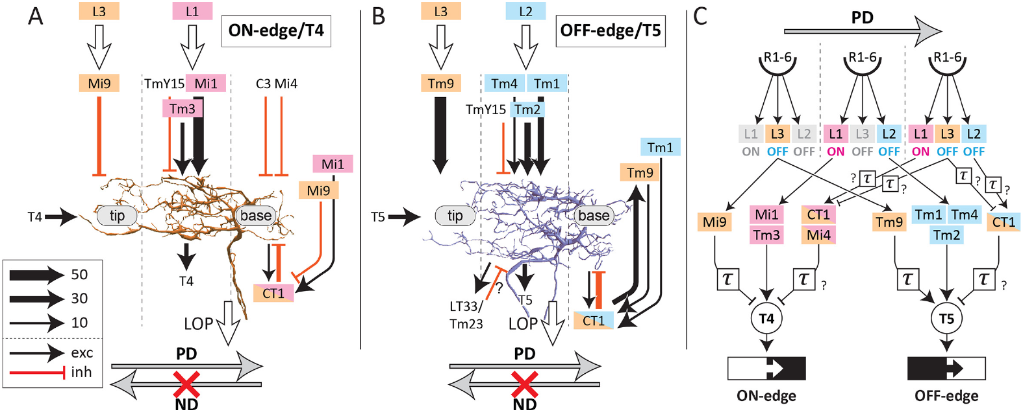
Bright and dark edges use parallel motion pathways
An ON edge increases brightness as it passes a visual location; an OFF edge decreases it. The fly processes these motion signals through parallel pathways: T4 primarily carries ON-edge motion and T5 primarily carries OFF-edge motion.
Serial electron microscopy places the T4 and T5 input networks in M10 and Lo1, respectively. T4 receives medulla inputs including Mi1 and Tm3; T5 receives inputs including Tm1, Tm2, Tm4 and Tm9. Each pathway samples spatially arranged signals rather than a single intensity measurement.
Haag and colleagues measured direction-dependent calcium responses in both pathways. Parallel organization means different input populations and different edge preferences, with the two pathways converging onto separate dendrites before their axons enter the lobula plate.
Shinomiya et al. (2019), Fig. 6. ON and OFF inputs converge onto distinct dendrites.
Haag et al. (2017); Shinomiya et al. (2019)
16
Notes:
• ON and OFF describe changes at a fixed visual location, rather than two classes of permanently bright and dark objects. A bright object can create an ON edge at its front and an OFF edge at its rear.
• The two pathways converge on different dendrites before their axons enter the lobula plate. Their input populations are different, but the spatial arrangement of those inputs permits comparable local comparisons.
• Edge preference is a property of the measured motion response. It should not be treated as proof that every synaptic input has been rectified into only one contrast sign or that the pathway is insensitive to changes of the other sign.
References:
Haag J, Mishra A, Borst A (2017). A common directional tuning mechanism of Drosophila motion-sensing neurons in the ON and in the OFF pathway. eLife 6:e29044. https://doi.org/10.7554/elife.29044
Shinomiya K, Huang G, Lu Z, Parag T, Xu CS, Aniceto R, Ansari N, Cheatham N, Lauchie S, Neace E, Ogundeyi O, Ordish C, Peel D, Shinomiya A, Smith C, Takemura S, Talebi I, Rivlin PK, Nern A, Scheffer LK, Plaza SM, Meinertzhagen IA (2019). Comparisons between the ON- and OFF-edge motion pathways in the Drosophila brain. eLife 8:e40025. https://doi.org/10.7554/elife.40025
Figure: Shinomiya et al. (2019), Fig. 6. ON and OFF inputs converge onto distinct dendrites.
Figure source: https://doi.org/10.7554/elife.40025

Slide 23
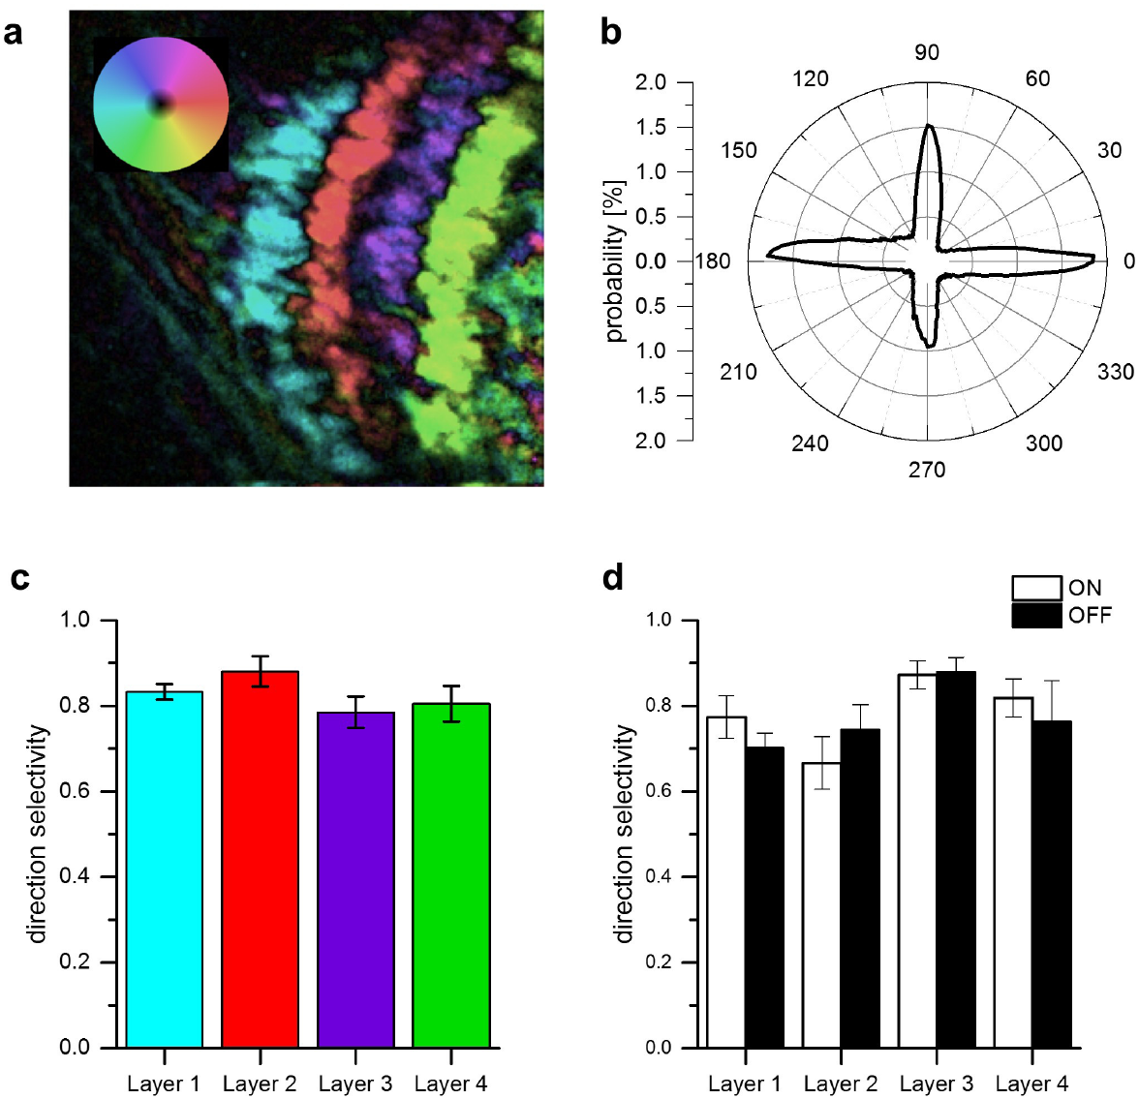
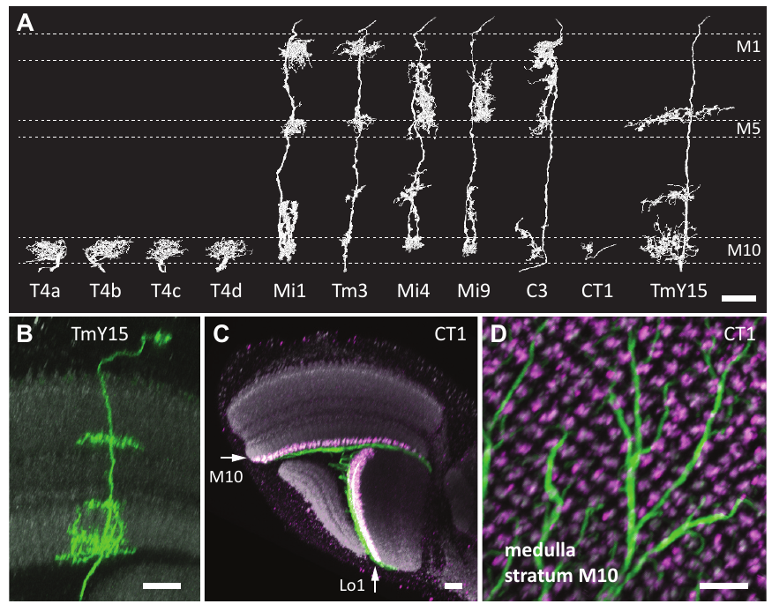
Four neuron subtypes encode four motion directions
T4 and T5 each comprise four directional subtypes. Their axons terminate in four lobula plate layers representing front-to-back, back-to-front, upward and downward motion. A preferred direction produces the stronger response; its opposite is the null direction.
Haag and colleagues imaged calcium signals while gratings moved in different directions. Each layer contained neurons with a corresponding tuning preference, and both ON and OFF neurons contributed to the same layer-specific direction representation.
The layers organize motion direction rather than contrast polarity: matching T4 and T5 subtypes converge despite their different edge preferences. Takemura's electron-microscopic reconstructions distinguish the T4 subtypes anatomically. Combining reconstruction with functional tuning links dendritic organization to a direction-specific output channel.
Haag et al. (2017), Fig. 4. Directional tuning across four output layers.
Takemura et al. (2017), Fig. 2(A–D). Reconstructed T4 subtypes and optic-lobe anatomy.
Haag et al. (2017); Takemura et al. (2017)
17
Notes:
• The four layers contain a set of directional channels repeated across the visual field. Within a layer, signals from bright-edge and dark-edge detectors share a directional preference.
• Preferred direction is defined from the response, not from the visual stimulus alone. The null direction is the opposite motion axis for that particular neuron; it can evoke a weak response or suppress activity depending on the cell and stimulus.
• Calcium imaging assigns functional tuning, whereas electron microscopy traces the corresponding processes. Those methods answer complementary questions: which direction activates the neuron, and where its inputs and outputs are located.
References:
Haag J, Mishra A, Borst A (2017). A common directional tuning mechanism of Drosophila motion-sensing neurons in the ON and in the OFF pathway. eLife 6:e29044. https://doi.org/10.7554/elife.29044
Takemura SY, Nern A, Chklovskii DB, Scheffer LK, Rubin GM, Meinertzhagen IA (2017). The comprehensive connectome of a neural substrate for 'ON' motion detection in Drosophila. eLife 6:e24394. https://doi.org/10.7554/elife.24394
Figure: Haag et al. (2017), Fig. 4. Directional tuning across four output layers.
Figure source: https://doi.org/10.7554/elife.29044
Figure: Takemura et al. (2017), Fig. 2(A–D). Reconstructed T4 subtypes and optic-lobe anatomy.
Figure source: https://doi.org/10.7554/elife.24394

Slide 24
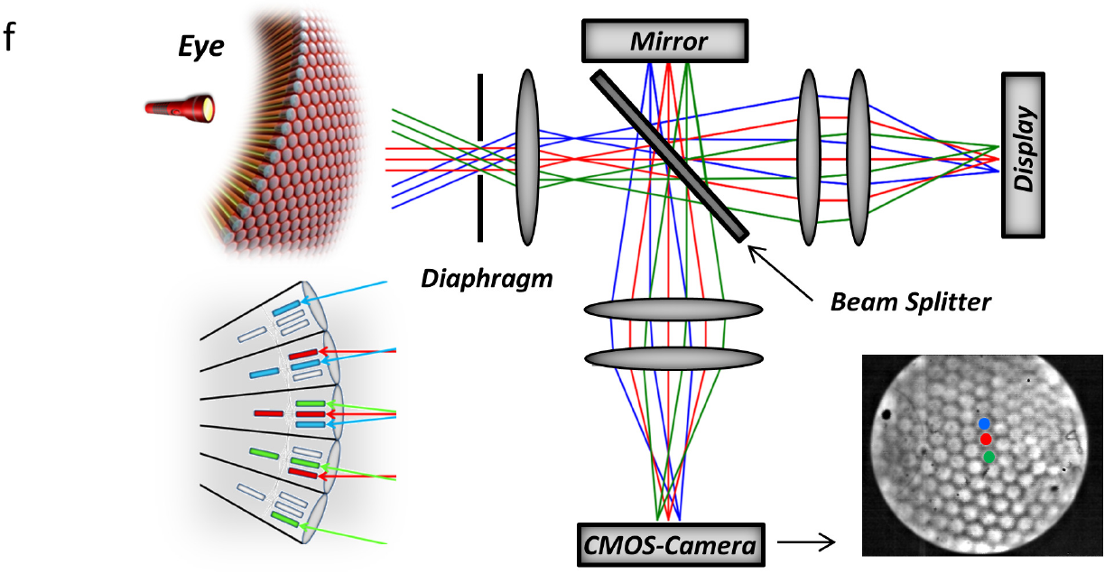
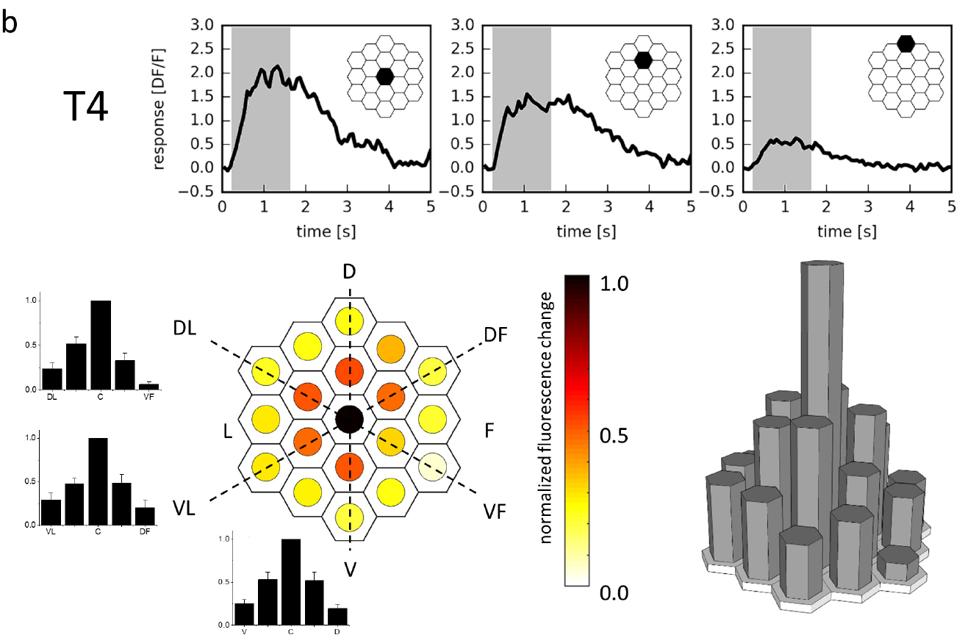
Calcium imaging resolves individual receptive fields
A receptive field is the set of visual positions influencing a neuron's response. Haag and colleagues stimulated individual ommatidia, the repeated optical units of the compound eye, while imaging T4/T5 terminals in the lobula plate.
A custom optical system directed light to selected positions among 716 points covering approximately 60° by 60°. GCaMP6m, a genetically encoded fluorescent calcium indicator, reported activity as ΔF/F, the fluorescence change relative to its baseline.
T4 neurons responded most strongly near the receptive-field center and less strongly at neighboring positions. Because each location was tested individually, the map gives the response that every position contributes alone, the baseline against which a stimulus sequence can be judged for a nonlinear interaction.
Haag et al. (2016), Fig. 1(f). Single-ommatidium stimulation optics.
Haag et al. (2016), Fig. 2(b). Measured T4 receptive field and local calcium responses.
Haag et al. (2016)
18
Notes:
• Each ommatidium samples a restricted direction in visual space. Directing stimulation to individual optical units gives more precise spatial control than moving a broad grating alone.
• GCaMP changes fluorescence when intracellular calcium changes. Normalizing the change to baseline fluorescence allows responses from labeled terminals to be compared while preserving the source's ΔF/F measurement scale.
• A receptive-field map describes how different positions influence the measured response. Testing locations individually is essential before interpreting a sequence, because a stronger sequence response could otherwise reflect unequal sensitivity to its component locations rather than a nonlinear interaction.
References:
Haag J, Arenz A, Serbe E, Gabbiani F, Borst A (2016). Complementary mechanisms create direction selectivity in the fly. eLife 5:e17421. https://doi.org/10.7554/elife.17421
Figure: Haag et al. (2016), Fig. 1(f). Single-ommatidium stimulation optics.
Figure source: https://doi.org/10.7554/elife.17421
Figure: Haag et al. (2016), Fig. 2(b). Measured T4 receptive field and local calcium responses.
Figure source: https://doi.org/10.7554/elife.17421

Slide 25
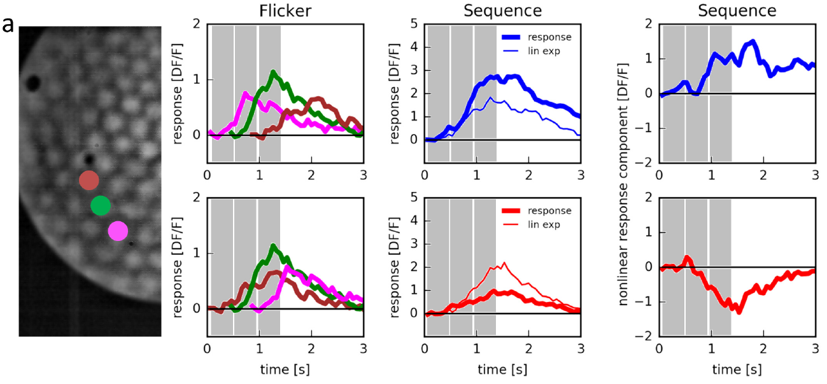
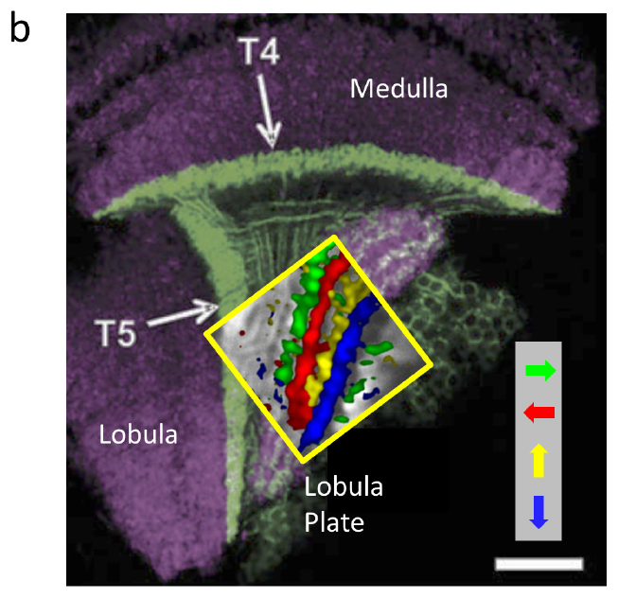
T4 responses depend on the order of local stimulation
A linear prediction adds the responses to separately presented inputs. Haag and colleagues first measured flashes at three neighboring locations, then compared their sum with the response when the same locations were stimulated in a motion sequence.
Preferred-direction sequences produced a measured T4 calcium response larger than the linear prediction. Reversing the order produced a smaller response than predicted, despite using the same spatial positions. The order-dependent difference is a nonlinear interaction, because addition alone cannot reproduce it.
Subtracting the linear prediction from the measured response separated enhancement from suppression. Because only the order of the same positions changed between the two sequences, the directional difference is a nonlinear interaction at or before T4 output rather than a consequence of unequal brightness or a stronger central flash.
Haag et al. (2016), Fig. 3(a). Single-location controls and sequential T4 responses.
Haag et al. (2016), Fig. 1(b). T4/T5 anatomical compartments.
Haag et al. (2016)
19
Notes:
• Separate flashes supply the control responses for each location. Their sum is the response expected if the neuron combined the inputs independently and linearly.
• Changing only the order changes the motion direction while retaining the tested positions. T4 responses exceeded the sum for one order and fell below it for the reverse order, so the directional effect cannot be reduced to unequal brightness or a stronger central flash.
• The nonlinear component is an analytical difference between measured responses, not an extra biological signal recorded at a synapse. It constrains how the pathway combines inputs, while leaving the membrane and synaptic implementation to other experiments.
References:
Haag J, Arenz A, Serbe E, Gabbiani F, Borst A (2016). Complementary mechanisms create direction selectivity in the fly. eLife 5:e17421. https://doi.org/10.7554/elife.17421
Figure: Haag et al. (2016), Fig. 3(a). Single-location controls and sequential T4 responses.
Figure source: https://doi.org/10.7554/elife.17421
Figure: Haag et al. (2016), Fig. 1(b). T4/T5 anatomical compartments.
Figure source: https://doi.org/10.7554/elife.17421

Slide 26
A linear prediction is the baseline for nonlinearity
A linear prediction adds the responses to inputs presented separately. If a T4 neuron combined its inputs independently, the response to a motion sequence across three neighboring locations would equal the sum of the responses to flashes at each location.
Haag and colleagues measured the flash responses first, then presented the same three locations in sequence in each order. The preferred-direction order produced a response larger than the sum, and the reverse order produced a response smaller than the sum, with the positions unchanged.
Subtracting the linear prediction from the measured response isolates the nonlinear component, positive for enhancement and negative for suppression. The computation of direction therefore lies at or before T4 output and depends on the order of stimulation.
Haag et al. (2016), Fig. 3(a). Single-location controls and sequential T4 responses.
Haag et al. (2016), Fig. 1(b). T4/T5 anatomical compartments.
Haag et al. (2016)
19a
Notes:
• A nonlinear interaction is defined against what independent inputs would produce, so the single-location flashes are the control for every sequence experiment.
• The control measurements.
– Each location was flashed alone, and the sum of those responses is the response expected if the neuron combined the inputs linearly.
• The test.
– The same positions were stimulated in a motion sequence, and the measured response was compared with the sum.
– Responses exceeded the sum in the preferred order and fell below it in the reverse order.
• The nonlinear component is a difference between measured responses.
– It is an analytical quantity computed by subtraction, not an extra signal recorded at a synapse.
– Positive values mean enhancement and negative values mean suppression, and both constrain how the pathway combines inputs.
• Why the order comparison is a strong test.
– Changing only the order changes the motion direction while the tested positions stay the same.
– T4 responses exceeded the sum for one order and fell below it for the reverse order, so the directional effect cannot be reduced to unequal brightness or to a stronger central flash.
References:
Haag J, Arenz A, Serbe E, Gabbiani F, Borst A (2016). Complementary mechanisms create direction selectivity in the fly. eLife 5:e17421. https://doi.org/10.7554/elife.17421

Slide 27
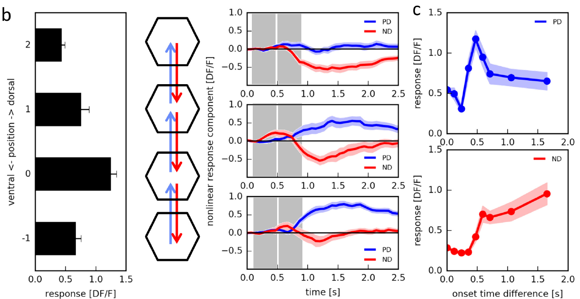
Preferred-direction stimulation enhances responses
Preferred-direction enhancement means that a spatial sequence produces more activity than expected from adding its individual inputs. Haag and colleagues varied which positions were paired and the interval between them while monitoring T4 calcium signals.
Enhancement depended on the position of the preceding stimulus relative to the receptive-field center. Its largest measured contribution occurred at an onset separation near 0.1 s; changing the interval weakened the effect. The directional interaction therefore has both spatial and temporal structure.
A delayed excitatory interaction is consistent with a Reichardt-like enhancement mechanism, in which a delayed signal from one position combines multiplicatively with the signal arriving from its neighbor. The roughly 0.1 s optimum belongs to this calcium-imaging protocol and differs from the delay of about 25 ms fitted to fly turning behavior.
Haag et al. (2016), Fig. 3(b, c). Position and timing affect the nonlinear response.
Haag et al. (2016), Fig. 1(b). T4/T5 anatomical compartments.
Haag et al. (2016)
20
Notes:
• The enhancement is defined relative to individually measured flashes. It concerns the additional response contributed by their sequence, rather than a simple comparison between strong and weak stimulation.
• Only particular spatial pairings produced strong enhancement, and the timing between the inputs also mattered. The roughly one-tenth-second optimum belongs to this calcium-imaging stimulus protocol, not to every effective delay previously fitted from behavior.
• A computational multiplier describes an input-output relationship. Several membrane and synaptic interactions can generate supralinear responses, so matching that relationship is evidence for the operation without uniquely identifying its implementation.
References:
Haag J, Arenz A, Serbe E, Gabbiani F, Borst A (2016). Complementary mechanisms create direction selectivity in the fly. eLife 5:e17421. https://doi.org/10.7554/elife.17421
Figure: Haag et al. (2016), Fig. 3(b, c). Position and timing affect the nonlinear response.
Figure source: https://doi.org/10.7554/elife.17421
Figure: Haag et al. (2016), Fig. 1(b). T4/T5 anatomical compartments.
Figure source: https://doi.org/10.7554/elife.17421

Slide 28
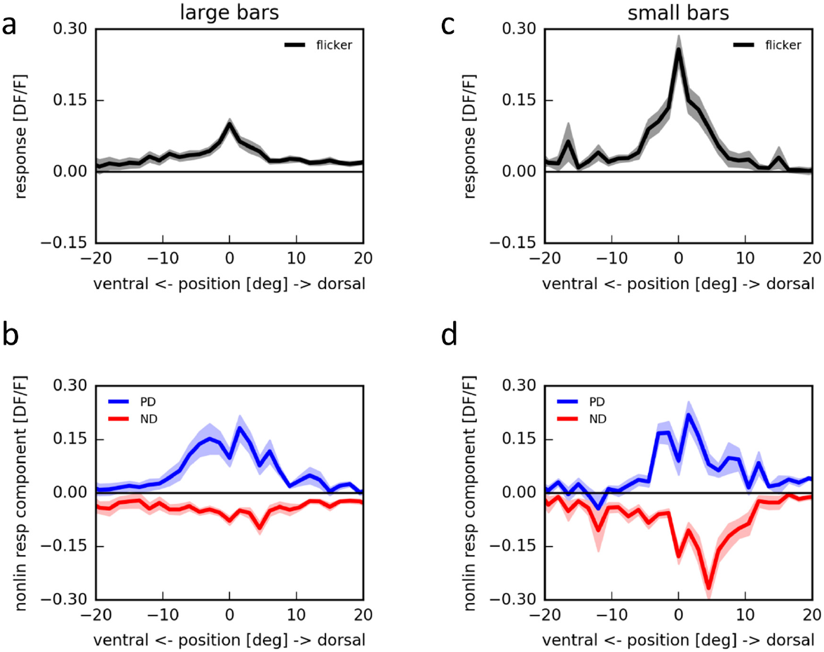
Null-direction stimulation suppresses responses
Null-direction suppression occurs when the reverse spatial sequence reduces a neuron's response below the linear prediction. Haag and colleagues measured this effect both with targeted ommatidium stimulation and with bars on an LED arena.
On the arena, isolated bars identified positions that excited T4. Sequential stimulation could nevertheless produce a negative nonlinear component for motion in the null direction. A response to one component therefore does not determine the response to its pairing with another.
Suppression is compatible with an inhibitory or divisive interaction, but the calcium response alone does not distinguish those biophysical possibilities. It complements preferred-direction enhancement: directional tuning can reflect both an increased response to one sequence and a reduced response to its reverse.
Haag et al. (2016), Fig. 1(b). T4/T5 anatomical compartments.
Haag et al. (2016), Fig. 4. Sequential bars produce below-linear null-direction responses.
Haag et al. (2016)
21
Notes:
• A negative nonlinear component means that the measured sequence response is smaller than the sum of its component responses. It does not necessarily mean that the absolute calcium signal is below baseline.
• Repeating the experiment with an LED arena provided a second stimulation method. The arrangement retained separate flash controls, so reduced sequence activity could be related to the same local inputs tested individually.
• Enhancement and suppression make different contributions to directional tuning. Suppression may involve inhibitory input or another interaction that reduces the effective excitation, but a fluorescence recording does not measure the synaptic current needed to choose uniquely between those mechanisms.
References:
Haag J, Arenz A, Serbe E, Gabbiani F, Borst A (2016). Complementary mechanisms create direction selectivity in the fly. eLife 5:e17421. https://doi.org/10.7554/elife.17421
Figure: Haag et al. (2016), Fig. 4. Sequential bars produce below-linear null-direction responses.
Figure source: https://doi.org/10.7554/elife.17421
Figure: Haag et al. (2016), Fig. 1(b). T4/T5 anatomical compartments.
Figure source: https://doi.org/10.7554/elife.17421

Slide 29
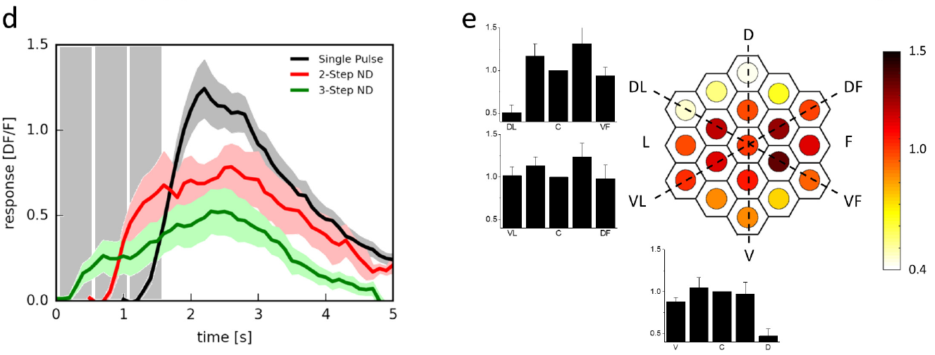
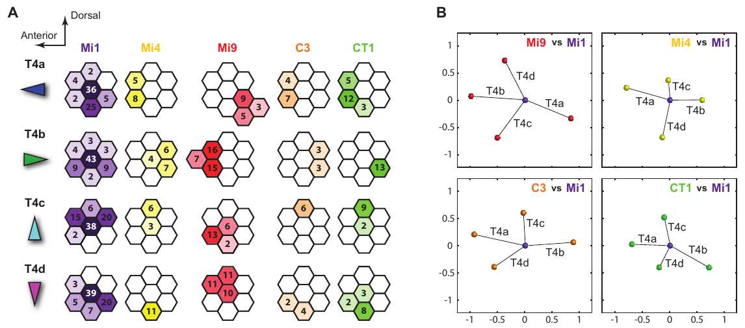
Enhancement and suppression occupy different positions
A T4 receptive field contains spatially different contributions to direction selectivity. Haag and colleagues mapped the nonlinear effects of stimulating the center together with neighboring ommatidia. Enhancement and suppression were concentrated on different sides of the center.
Takemura and colleagues reconstructed synaptic partners across neighboring medulla columns. Inputs from Mi1 and Tm3 were concentrated centrally, whereas other input types occupied displaced regions of the T4 dendrite. Spatial asymmetry is therefore present in both functional responses and anatomical connectivity.
The studies used different measurements and preparations, one imaging calcium responses and the other counting and locating synapses. Both found structured contributions around the center, and the displaced inputs are candidate sources of the spatial asymmetry that makes reversing a sequence change the combined response.
Haag et al. (2016), Fig. 3(d, e). Neighboring positions differ in their nonlinear influence.
Takemura et al. (2017), Fig. 4(A, B). T4 input distributions across neighboring columns.
Haag et al. (2016); Takemura et al. (2017)
22
Notes:
• Direction requires spatial asymmetry. If every input had the same location and time course, reversing a sequence would not necessarily produce a different combined response.
• The functional mapping measured changes in calcium, whereas the reconstruction counted and located synapses. Both found structured contributions around the center rather than an undifferentiated collection of inputs.
• The anatomical and functional results can be compared at the level of organization, but they cannot be treated as recordings from the same individual synapses. A candidate delayed input still requires physiological characterization, including its time course and sign.
References:
Haag J, Arenz A, Serbe E, Gabbiani F, Borst A (2016). Complementary mechanisms create direction selectivity in the fly. eLife 5:e17421. https://doi.org/10.7554/elife.17421
Takemura SY, Nern A, Chklovskii DB, Scheffer LK, Rubin GM, Meinertzhagen IA (2017). The comprehensive connectome of a neural substrate for 'ON' motion detection in Drosophila. eLife 6:e24394. https://doi.org/10.7554/elife.24394
Figure: Haag et al. (2016), Fig. 3(d, e). Neighboring positions differ in their nonlinear influence.
Figure source: https://doi.org/10.7554/elife.17421
Figure: Takemura et al. (2017), Fig. 4(A, B). T4 input distributions across neighboring columns.
Figure source: https://doi.org/10.7554/elife.24394

Slide 30
Spatial asymmetry makes stimulation order matter
Direction requires spatial asymmetry. If every input to a neuron had the same location and the same time course, reversing a stimulus sequence would not necessarily change the combined response, and the neuron could not tell the two directions apart.
Haag and colleagues found that enhancement and suppression were concentrated on different sides of the T4 receptive-field center. Takemura and colleagues found that reconstructed Mi1 and Tm3 inputs were concentrated centrally while other input types occupied displaced regions of the dendrite.
One study imaged calcium responses and the other counted and located synapses, yet both found structured contributions around the center rather than an undifferentiated collection of inputs. The displaced inputs are candidate sources of the delayed signal that makes reversing the sequence change the response.
Haag et al. (2016), Fig. 3(d, e). Neighboring positions differ in their nonlinear influence.
Takemura et al. (2017), Fig. 4(A, B). T4 input distributions across neighboring columns.
Haag et al. (2016); Takemura et al. (2017)
22a
Notes:
• A directional neuron needs inputs from different positions to contribute differently, and the functional and anatomical maps of T4 both show that organization.
• Why symmetry would fail.
– With identical locations and time courses, one order of stimulation and its reverse would add the same inputs in the same way.
– A difference between the two orders requires inputs that differ in position or timing.
• The functional map.
– Haag and colleagues stimulated the center together with neighboring ommatidia and measured the nonlinear effect at each position.
– Enhancement and suppression lay on different sides of the center.
• The anatomical map.
– Takemura and colleagues reconstructed synaptic partners across neighboring medulla columns.
– Mi1 and Tm3 inputs were concentrated centrally, while other input types occupied displaced regions of the T4 dendrite.
• Comparing the two at the level of organization.
– The calcium measurements and the synapse counts come from different preparations, so the correspondence is one of arrangement.
– Displaced inputs are candidates for the delayed contributions, and each still needs physiological measurement of its time course and sign.
References:
Haag J, Arenz A, Serbe E, Gabbiani F, Borst A (2016). Complementary mechanisms create direction selectivity in the fly. eLife 5:e17421. https://doi.org/10.7554/elife.17421
Takemura SY, Nern A, Chklovskii DB, Scheffer LK, Rubin GM, Meinertzhagen IA (2017). The comprehensive connectome of a neural substrate for 'ON' motion detection in Drosophila. eLife 6:e24394. https://doi.org/10.7554/elife.24394

Slide 31
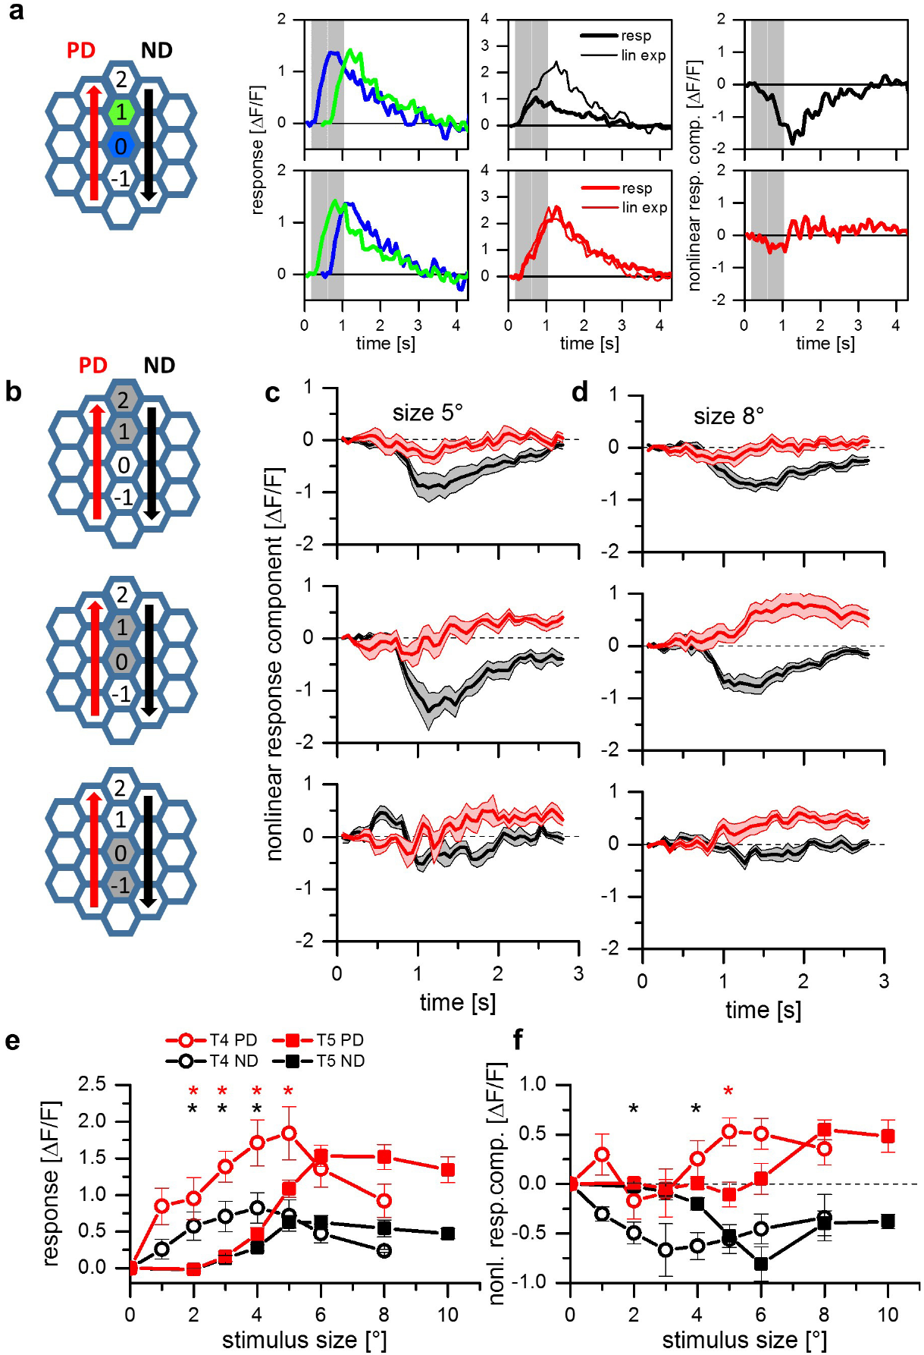
T5 combines the same complementary operations
T5 neurons preferentially respond to OFF-edge motion. Haag and colleagues stimulated neighboring visual columns with brightness decrements while imaging T5 terminal calcium, testing whether dark-edge motion required a different directional operation from T4.
A two-step sequence near the receptive-field center could produce both preferred-direction enhancement and null-direction suppression. Increasing the stimulus-spot diameter from 5° to 8° revealed preferred-direction enhancement alongside suppression.
The same classes of nonlinear operation can therefore occur in both ON and OFF pathways despite different input neurons and dendritic locations. T5 receives its inputs in the lobula, so the matching enhancement and suppression are an experimental result rather than a consequence of identical circuitry, and spacing mattered because T5's effective receptive-field organization differs from that of T4.
Haag et al. (2016), Fig. 1(b). T4/T5 anatomical compartments.
Haag et al. (2017), Fig. 2(a–f). OFF-cell sequences produce enhancement and suppression.
Haag et al. (2017); Shinomiya et al. (2019); Haag et al. (2016)
23
Notes:
• T5 receives its local inputs in the lobula rather than the T4 dendritic layer of the medulla. That anatomical difference makes the matching physiological operations an experimental result rather than an assumption based on identical circuitry.
• The authors used darkening stimuli and measured component flashes as controls for the sequence response. Both an excess in the preferred direction and a deficit in the null direction contributed to directional tuning.
• Spatial spacing affected the response because T5's effective receptive-field organization differed from that of T4. Similar enhancement and suppression categories do not mean that every parameter or every synaptic partner is the same in the two pathways.
References:
Haag J, Mishra A, Borst A (2017). A common directional tuning mechanism of Drosophila motion-sensing neurons in the ON and in the OFF pathway. eLife 6:e29044. https://doi.org/10.7554/elife.29044
Shinomiya K, Huang G, Lu Z, Parag T, Xu CS, Aniceto R, Ansari N, Cheatham N, Lauchie S, Neace E, Ogundeyi O, Ordish C, Peel D, Shinomiya A, Smith C, Takemura S, Talebi I, Rivlin PK, Nern A, Scheffer LK, Plaza SM, Meinertzhagen IA (2019). Comparisons between the ON- and OFF-edge motion pathways in the Drosophila brain. eLife 8:e40025. https://doi.org/10.7554/elife.40025
Haag J, Arenz A, Serbe E, Gabbiani F, Borst A (2016). Complementary mechanisms create direction selectivity in the fly. eLife 5:e17421. https://doi.org/10.7554/elife.17421
Figure: Haag et al. (2017), Fig. 2(a–f). OFF-cell sequences produce enhancement and suppression.
Figure source: https://doi.org/10.7554/elife.29044
Figure: Haag et al. (2016), Fig. 1(b). T4/T5 anatomical compartments.
Figure source: https://doi.org/10.7554/elife.17421

Slide 32
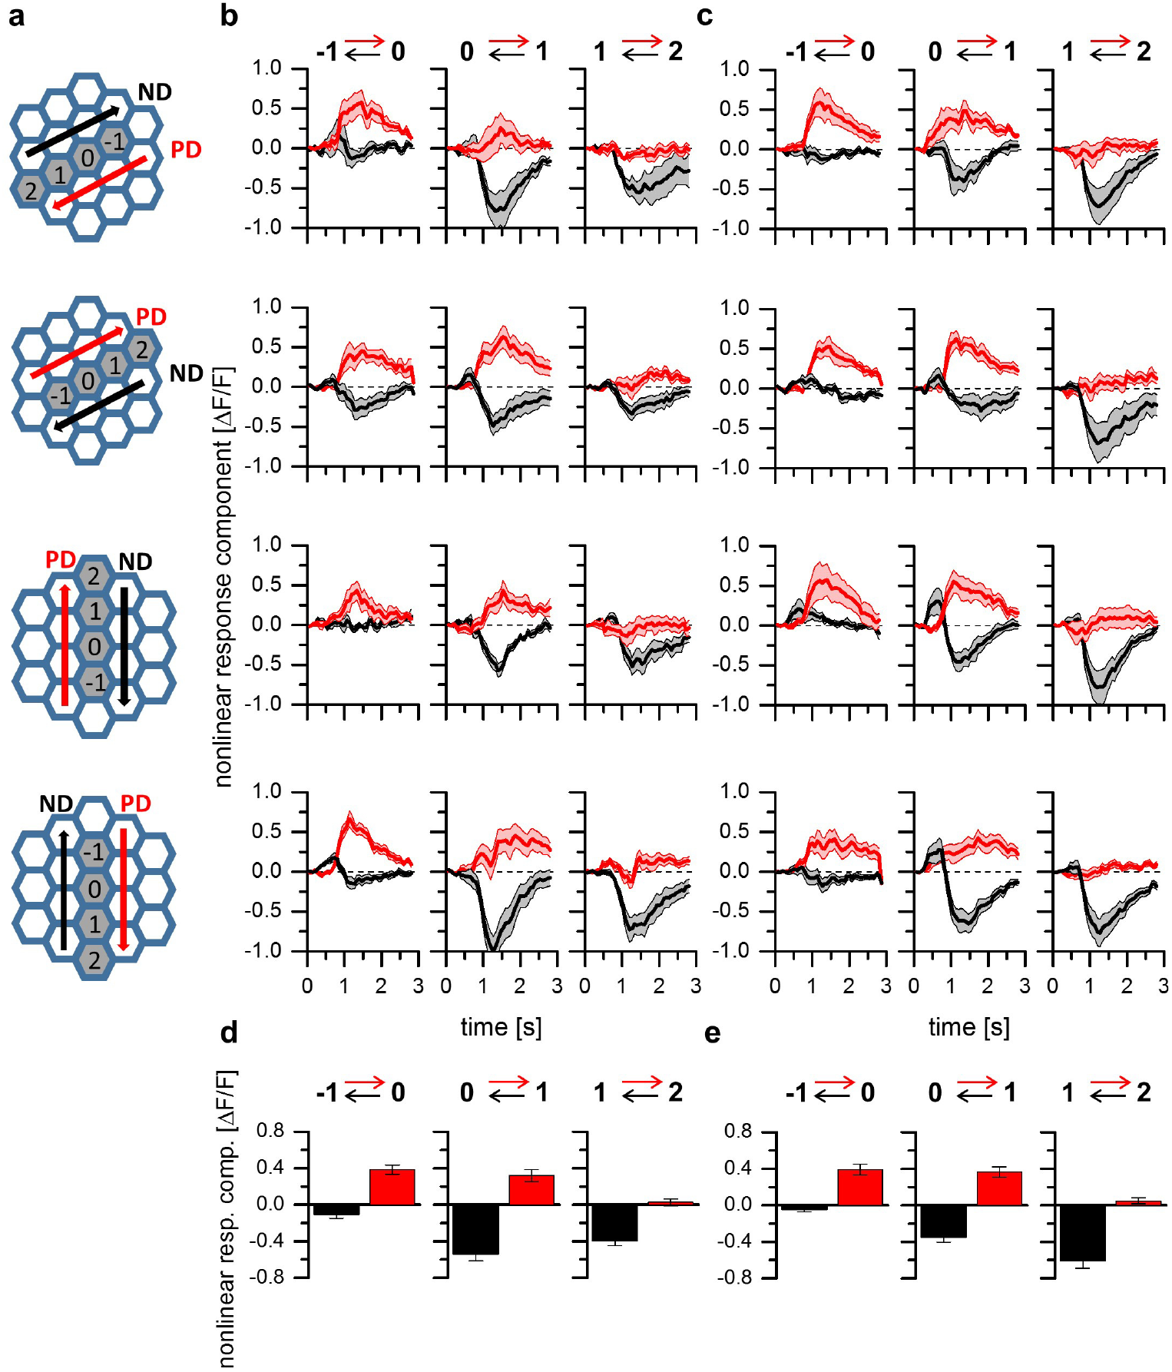
Complementary operations span all T4 and T5 subtypes
A mechanism measured in one directional subtype need not apply to all local motion neurons. Haag and colleagues compared T4 and T5 across all four lobula plate layers using two-step apparent-motion stimuli aligned with each subtype's preferred axis.
Preferred-direction enhancement occurred when the stimulus sequence traversed one side of the receptive field toward its center. Null-direction suppression occurred for the reverse sequence involving the complementary side. The comparison included both horizontal and vertical motion channels.
Enhancement and suppression therefore form a common functional organization across the tested ON and OFF subtypes. The same arrangement, enhancement on one side of the receptive field and suppression on the other, coexists with different receptive-field sizes or temporal filters in different subtypes.
Haag et al. (2017), Fig. 4. Four direction layers.
Haag et al. (2017), Fig. 3. Nonlinear responses across four ON and OFF subtypes.
Haag et al. (2017)
24
Notes:
• The four directional subtypes provide a stronger test than repeating an experiment only in a horizontal neuron. The stimulus geometry must be rotated to match each cell's preferred and null directions.
• The same two categories of nonlinear response were found in the horizontal and vertical channels of both T4 and T5. Direction-specific anatomy is therefore compatible with a repeated computational organization.
• Generality of the operation is different from equality of all parameters. Different receptive-field sizes or temporal filters can coexist with a common arrangement of enhancement on one side and suppression on the other.
References:
Haag J, Mishra A, Borst A (2017). A common directional tuning mechanism of Drosophila motion-sensing neurons in the ON and in the OFF pathway. eLife 6:e29044. https://doi.org/10.7554/elife.29044
Figure: Haag et al. (2017), Fig. 3. Nonlinear responses across four ON and OFF subtypes.
Figure source: https://doi.org/10.7554/elife.29044
Figure: Haag et al. (2017), Fig. 4. Four direction layers.
Figure source: https://doi.org/10.7554/elife.29044

Slide 33
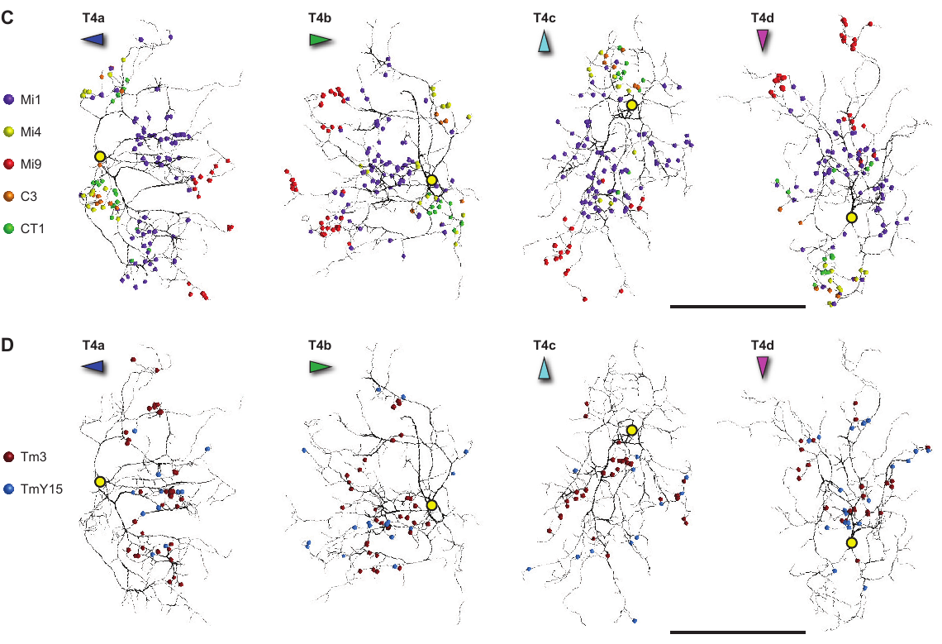
Synaptic partners occupy different parts of T4 dendrites
A connectome is a reconstruction of neurons and their synaptic connections. Takemura and colleagues traced inputs to four T4 subtypes in a focused-ion-beam scanning electron-microscopy volume, assigning contacts to identified presynaptic cell types.
Eight input classes accounted for more than 96% of the reconstructed T4 synapses. Their contacts were distributed unevenly: some concentrated along the dendritic shaft, some toward its tip, and others near the base. A dendrite therefore receives different combinations of signals at different locations.
Input position constrains which spatial signals can interact within T4, and the unequal distribution along the dendrite provides a physical substrate for unequal contributions from neighboring visual positions. Synapse number measures anatomical connectivity; the physiological effect of a contact also depends on release, receptor properties and the neuron's electrical state.
Takemura et al. (2017), Fig. 2(A–D). T4 inputs.
Takemura et al. (2017), Fig. 4(C, D). Synapse locations on four reconstructed T4 subtypes.
Takemura et al. (2017)
25
Notes:
• Electron microscopy identifies membrane contacts at a resolution sufficient to assign synapses to reconstructed neurons. The resulting connectome gives an input inventory rather than only a drawing of nearby processes.
• Most of the identified input was concentrated in eight classes, with distinct positions along the dendrite. That arrangement provides a physical substrate for unequal contributions from neighboring visual positions.
• More anatomical contacts need not mean proportionally greater functional current. The physiological effect also depends on release, receptor properties and the neuron's electrical state, none of which is measured directly by counting synapses in a fixed specimen.
References:
Takemura SY, Nern A, Chklovskii DB, Scheffer LK, Rubin GM, Meinertzhagen IA (2017). The comprehensive connectome of a neural substrate for 'ON' motion detection in Drosophila. eLife 6:e24394. https://doi.org/10.7554/elife.24394
Figure: Takemura et al. (2017), Fig. 4(C, D). Synapse locations on four reconstructed T4 subtypes.
Figure source: https://doi.org/10.7554/elife.24394
Figure: Takemura et al. (2017), Fig. 2(A–D). T4 inputs.
Figure source: https://doi.org/10.7554/elife.24394

Slide 34
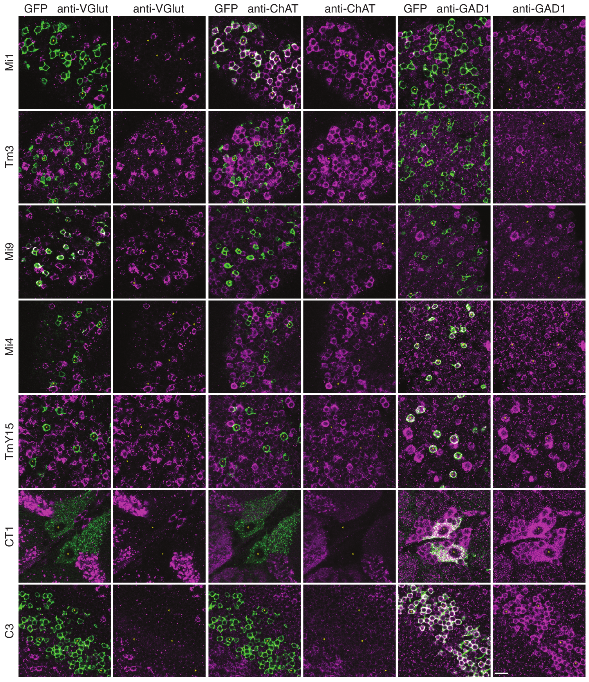
Central T4 inputs include Mi1 and Tm3
Mi1 and Tm3 are medulla interneurons relaying visual input to T4. Takemura and colleagues found that these two cell types supplied the largest portions of reconstructed T4 input, approximately 35% and 16% of its synaptic contacts, respectively.
Their synapses overlapped substantially along the dendritic shaft. Antibody labeling detected choline acetyltransferase, the enzyme that synthesizes acetylcholine, in Mi1 and Tm3. The combined anatomical and chemical evidence supports major cholinergic inputs to T4.
The expanded reconstruction did not reproduce a consistent Mi1–Tm3 spatial offset proposed from an earlier volume. The weight of the directional asymmetry therefore falls on additional displaced input channels and their functional time courses.
Takemura et al. (2017), Fig. 4(C, D). T4 synapses.
Takemura et al. (2017), Fig. 5. Transmitter-marker staining of T4 inputs.
Takemura et al. (2017)
26
Notes:
• Mi1 and Tm3 are major input pathways, but major does not mean sufficient by themselves. They account for large fractions of the reconstructed contacts and overlap over much of the same dendritic region.
• Choline acetyltransferase is a marker of the ability to synthesize acetylcholine. Detecting it in labeled neurons supplies chemical evidence that complements the connection tracing, rather than measuring transmitter release at a particular synapse.
• The newer reconstruction could not reproduce the earlier proposed consistent displacement between Mi1 and Tm3. This limits a simple two-input explanation based solely on those anatomical centers and leaves other input channels as necessary candidates for the directional asymmetry.
References:
Takemura SY, Nern A, Chklovskii DB, Scheffer LK, Rubin GM, Meinertzhagen IA (2017). The comprehensive connectome of a neural substrate for 'ON' motion detection in Drosophila. eLife 6:e24394. https://doi.org/10.7554/elife.24394
Figure: Takemura et al. (2017), Fig. 5. Transmitter-marker staining of T4 inputs.
Figure source: https://doi.org/10.7554/elife.24394
Figure: Takemura et al. (2017), Fig. 4(C, D). T4 synapses.
Figure source: https://doi.org/10.7554/elife.24394

Slide 35
T4 also receives inhibitory and glutamatergic inputs
Mi4 and Mi9 contribute spatially displaced inputs to T4. Takemura and colleagues combined synapse reconstruction with immunolabeling, staining identified cell bodies for acetylcholine, glutamate and GABA-related markers rather than assigning chemistry from morphology alone.
Mi4 labeled for GAD1, glutamic acid decarboxylase, which synthesizes the neurotransmitter GABA. Mi9 labeled for VGlut, a transporter that packages glutamate into synaptic vesicles. These markers support GABAergic and glutamatergic input identities, respectively.
Glutamate is not necessarily excitatory in the fly. T4/T5 transcriptomics detected GluClα, a glutamate-gated chloride channel associated with hyperpolarizing responses. Input chemistry, receptor identity and membrane conditions jointly determine response sign; a transmitter marker alone does not measure the current at a T4 synapse.
Takemura et al. (2017), Fig. 2(A–D). T4 inputs.
Takemura et al. (2017), Fig. 5. Transmitter markers in identified T4 input neurons.
Takemura et al. (2017); Pankova & Borst (2016)
27
Notes:
• GABA and glutamate are chemical transmitters, but a transmitter's effect depends on the receptor activated in the receiving neuron. The marker stains identify synthetic or packaging machinery in particular input cells.
• Mi4 carries the GABA-synthesis marker and Mi9 the vesicular glutamate marker. Their displaced synaptic locations make them candidates for spatially asymmetric contributions, while the staining distinguishes their chemistry from the central cholinergic inputs.
• GluClα provides a mechanism through which glutamate can activate a chloride conductance rather than a depolarizing cation conductance. Its transcript in the pooled T4/T5 population supports a possible inhibitory response, but does not establish receptor placement at every reconstructed Mi9 contact.
References:
Takemura SY, Nern A, Chklovskii DB, Scheffer LK, Rubin GM, Meinertzhagen IA (2017). The comprehensive connectome of a neural substrate for 'ON' motion detection in Drosophila. eLife 6:e24394. https://doi.org/10.7554/elife.24394
Pankova K, Borst A (2016). RNA-Seq Transcriptome Analysis of Direction-Selective T4/T5 Neurons in Drosophila. PLoS ONE 11:e0163986. https://doi.org/10.1371/journal.pone.0163986
Figure: Takemura et al. (2017), Fig. 5. Transmitter markers in identified T4 input neurons.
Figure source: https://doi.org/10.7554/elife.24394
Figure: Takemura et al. (2017), Fig. 2(A–D). T4 inputs.
Figure source: https://doi.org/10.7554/elife.24394

Slide 36
A transmitter's effect depends on the receptor it activates
GABA and glutamate are chemical transmitters, but the effect on the receiving neuron depends on which receptor binds them. The antibody stains used by Takemura and colleagues mark synthesis or packaging machinery in identified input cells, such as the GABA-synthesizing enzyme GAD1 in Mi4 and the vesicular glutamate transporter VGlut in Mi9.
In the fly, glutamate is not necessarily excitatory. GluClα is a glutamate-gated chloride channel, and opening a chloride conductance produces a hyperpolarizing response rather than the depolarizing response of a cation channel.
Pankova and Borst detected GluClα transcripts in the pooled T4/T5 population. Together with the displaced positions of Mi4 and Mi9 contacts on the T4 dendrite, input chemistry and receptor identity make these cells candidates for spatially asymmetric, inhibitory contributions, whereas the central Mi1 and Tm3 inputs are cholinergic.
Takemura et al. (2017), Fig. 2(A–D). T4 inputs.
Takemura et al. (2017), Fig. 5. Transmitter markers in identified T4 input neurons.
Takemura et al. (2017); Pankova & Borst (2016)
27a
Notes:
• A transmitter marker names the chemistry of the presynaptic cell, and the response sign comes from the receptor on the receiving neuron.
• What the stains identify.
– Mi4 carries the GABA-synthesis marker GAD1, and Mi9 carries the vesicular glutamate transporter VGlut.
– These markers identify synthetic or packaging machinery in the input cells and distinguish their chemistry from the central cholinergic inputs.
• Glutamate acting on an inhibitory receptor.
– GluClα is a glutamate-gated chloride channel, so glutamate acting through it can hyperpolarize the receiving neuron.
– Its transcript appears in the pooled T4/T5 population, which supports a possible inhibitory response.
• Combining chemistry with position.
– Mi4 and Mi9 contact the T4 dendrite at displaced locations, which makes them candidates for the spatially asymmetric contributions that direction selectivity requires.
• Chemistry, receptor and membrane state decide the sign.
– Response sign depends on the input chemistry, the receptor identity and the conditions of the membrane together.
– A transmitter marker names the machinery of the input cell, so measuring the current at a T4 synapse requires a physiological recording.
References:
Takemura SY, Nern A, Chklovskii DB, Scheffer LK, Rubin GM, Meinertzhagen IA (2017). The comprehensive connectome of a neural substrate for 'ON' motion detection in Drosophila. eLife 6:e24394. https://doi.org/10.7554/elife.24394
Pankova K, Borst A (2016). RNA-Seq Transcriptome Analysis of Direction-Selective T4/T5 Neurons in Drosophila. PLoS ONE 11:e0163986. https://doi.org/10.1371/journal.pone.0163986

Slide 37
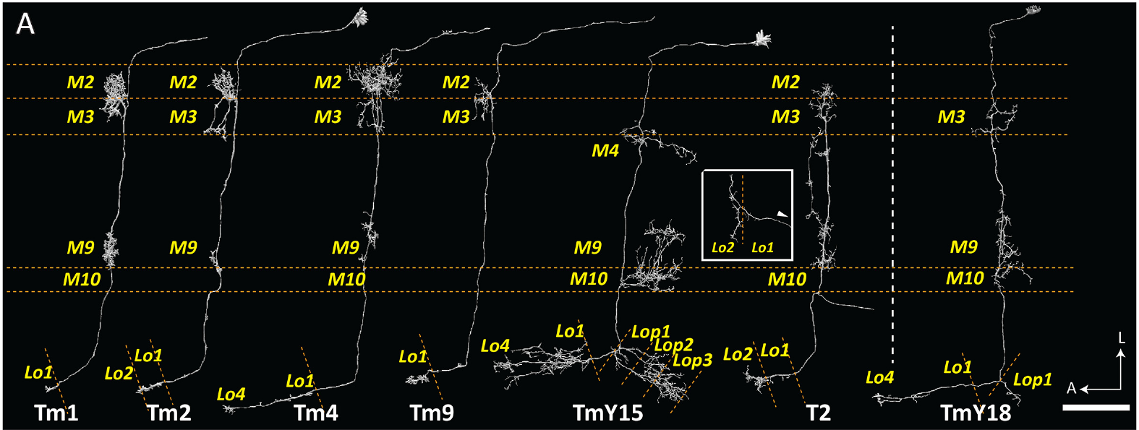
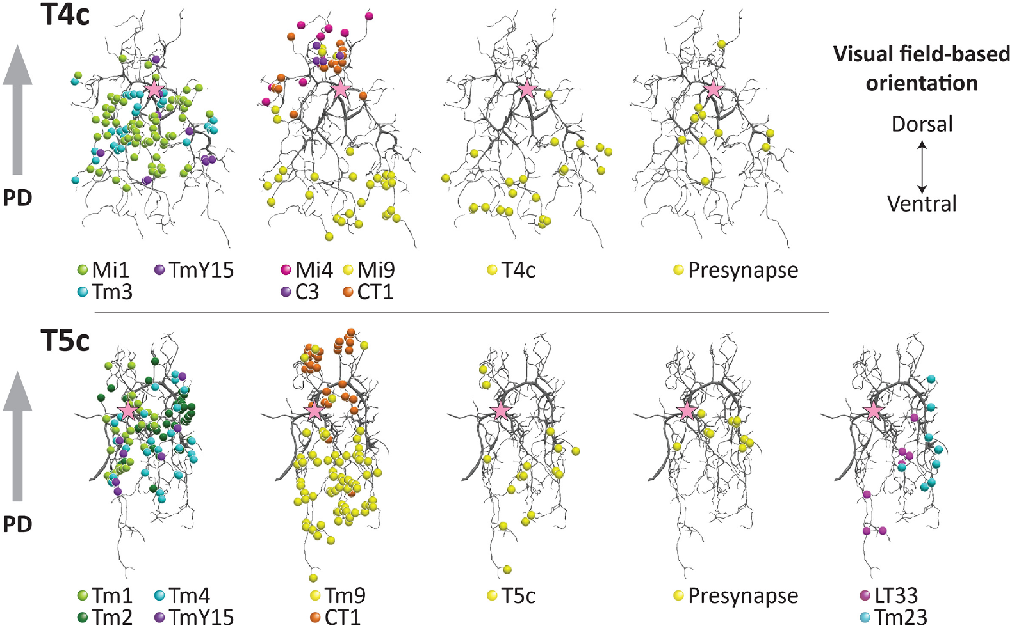
OFF-pathway inputs converge on T5 dendrites
The transmedullary neurons Tm1, Tm2, Tm4 and Tm9 carry signals from the medulla to the lobula. Shinomiya and colleagues reconstructed their connections onto T5 dendrites in Lo1, linking the OFF pathway's relay cells to local motion computation.
Input locations were organized across each T5 dendrite. Tm1, Tm2 and Tm4 contributed centrally, while Tm9 supplied contacts displaced toward the dendritic tip. Other partners, including CT1, contributed near different dendritic regions.
These spatial relationships resemble the differentiated input zones of T4 while using a different set of relay neurons. Central and displaced input classes can therefore deliver distinct information to different parts of the same T5 dendrite.
Shinomiya et al. (2019), Fig. 3(A). Reconstructed OFF-pathway input neurons.
Shinomiya et al. (2019), Fig. 4. Synaptic distributions on T4 and T5 dendrites.
Shinomiya et al. (2019)
28
Notes:
• Transmedullary describes the route through the optic neuropils: these neurons relay medulla signals into the lobula. Their repeated columnar positions preserve a relationship to the local visual field.
• The T5 dendrite is not contacted uniformly by all relay types. Central input classes and displaced input classes can provide distinct information to different parts of the same receiving neuron.
• Similar geometry in the ON and OFF circuits does not make their relay cells interchangeable. The anatomy establishes where information can enter, while a recording or causal perturbation is needed to determine the timing and influence of each input.
References:
Shinomiya K, Huang G, Lu Z, Parag T, Xu CS, Aniceto R, Ansari N, Cheatham N, Lauchie S, Neace E, Ogundeyi O, Ordish C, Peel D, Shinomiya A, Smith C, Takemura S, Talebi I, Rivlin PK, Nern A, Scheffer LK, Plaza SM, Meinertzhagen IA (2019). Comparisons between the ON- and OFF-edge motion pathways in the Drosophila brain. eLife 8:e40025. https://doi.org/10.7554/elife.40025
Figure: Shinomiya et al. (2019), Fig. 3(A). Reconstructed OFF-pathway input neurons.
Figure source: https://doi.org/10.7554/elife.40025
Figure: Shinomiya et al. (2019), Fig. 4. Synaptic distributions on T4 and T5 dendrites.
Figure source: https://doi.org/10.7554/elife.40025

Slide 38
ON and OFF circuits share a spatial organization
A presynaptic neuron supplies a synaptic output, whereas the postsynaptic neuron receives it. Shinomiya and colleagues mapped input and output contacts along reconstructed T4 and T5 dendrites, distinguishing their partners and the direction of transmission.
Both pathways combined central contacts, displaced tip contacts and base-associated contacts. T4 received inputs including Mi1, Tm3, Mi9 and inhibitory partners; T5 combined Tm1, Tm2, Tm4, Tm9 and CT1. Four directional subtypes rotated the effective arrangement relative to visual space.
The shared pattern is a repeated organizational principle, not identical wiring. Additional partners and local outputs differ between the pathways. A circuit comparison therefore supports common computational constraints while preserving pathway-specific opportunities for timing, feedback and contrast dependence.
Shinomiya et al. (2019), Fig. 4. ON and OFF synapses occupy comparable dendritic zones.
Shinomiya et al. (2019)
29
Notes:
• Tracing a contact requires identifying which neuron is presynaptic and which is postsynaptic. A dendrite can also provide local output, so proximity alone does not determine the direction of information flow.
• The investigators found comparable distributions of central and displaced input in the two pathways, using different named partners. Rotating the arrangement across directional subtypes allows related local computations to support different preferred directions.
• The reconstruction also includes connections that differ between T4 and T5. Those differences can influence the circuit without invalidating the shared organization, and they prevent the two pathways from being reduced to exact copies distinguished only by bright versus dark stimuli.
References:
Shinomiya K, Huang G, Lu Z, Parag T, Xu CS, Aniceto R, Ansari N, Cheatham N, Lauchie S, Neace E, Ogundeyi O, Ordish C, Peel D, Shinomiya A, Smith C, Takemura S, Talebi I, Rivlin PK, Nern A, Scheffer LK, Plaza SM, Meinertzhagen IA (2019). Comparisons between the ON- and OFF-edge motion pathways in the Drosophila brain. eLife 8:e40025. https://doi.org/10.7554/elife.40025
Figure: Shinomiya et al. (2019), Fig. 4. ON and OFF synapses occupy comparable dendritic zones.
Figure source: https://doi.org/10.7554/elife.40025

Slide 39
Connectomes constrain circuits without measuring time
A spatially ordered input network can support delayed enhancement and suppression, but an anatomical contact does not specify a temporal filter. Synaptic counts and dendritic geometry constrain candidate motion computations without recording the activity of their input channels.
Takemura and Shinomiya reconstructed multiple relay routes reaching T4 or T5, including paths with different numbers of intervening synapses. Their published circuit accounts distinguish known connectivity from proposed excitatory, inhibitory and timing contributions.
Routes to T4 and T5 can contain different numbers of intervening neurons, and their effective timing also depends on membrane and synaptic dynamics. The spatially ordered inputs give the receiving neuron signals from different visual positions, and the delay between those signals can arise from route length and from synaptic properties, which is how the Reichardt algorithm and the connectome fit together.
Shinomiya et al. (2019), Fig. 6. Published circuit account distinguishes measured and proposed links.
Takemura et al. (2017); Shinomiya et al. (2019)
30
Notes:
• Anatomy places restrictions on possible computations because a receiving neuron can interact only with signals that reach it. It does not supply the full time course of those signals.
• Different routes can contain different numbers of intervening neurons, but their effective timing also depends on membrane and synaptic dynamics. Counting steps is therefore a hypothesis about delay rather than a delay measurement.
• The published circuit account combines established connections with proposed functional roles. Those categories must remain separate: a reconstructed input is evidence of connectivity, whereas its contribution to enhancement or suppression needs a physiological or causal test.
References:
Takemura SY, Nern A, Chklovskii DB, Scheffer LK, Rubin GM, Meinertzhagen IA (2017). The comprehensive connectome of a neural substrate for 'ON' motion detection in Drosophila. eLife 6:e24394. https://doi.org/10.7554/elife.24394
Shinomiya K, Huang G, Lu Z, Parag T, Xu CS, Aniceto R, Ansari N, Cheatham N, Lauchie S, Neace E, Ogundeyi O, Ordish C, Peel D, Shinomiya A, Smith C, Takemura S, Talebi I, Rivlin PK, Nern A, Scheffer LK, Plaza SM, Meinertzhagen IA (2019). Comparisons between the ON- and OFF-edge motion pathways in the Drosophila brain. eLife 8:e40025. https://doi.org/10.7554/elife.40025
Figure: Shinomiya et al. (2019), Fig. 6. Published circuit account distinguishes measured and proposed links.
Figure source: https://doi.org/10.7554/elife.40025

Slide 40
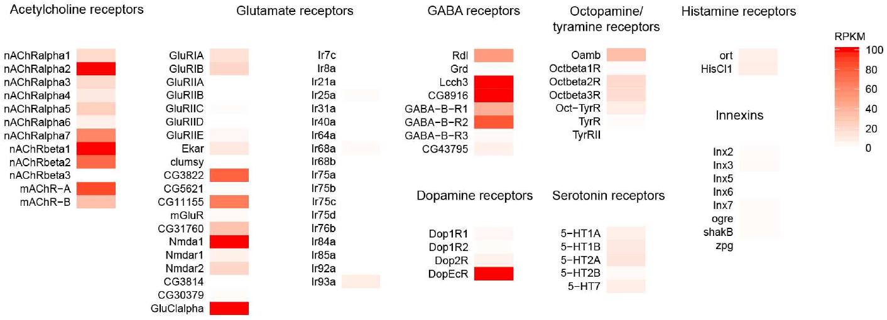
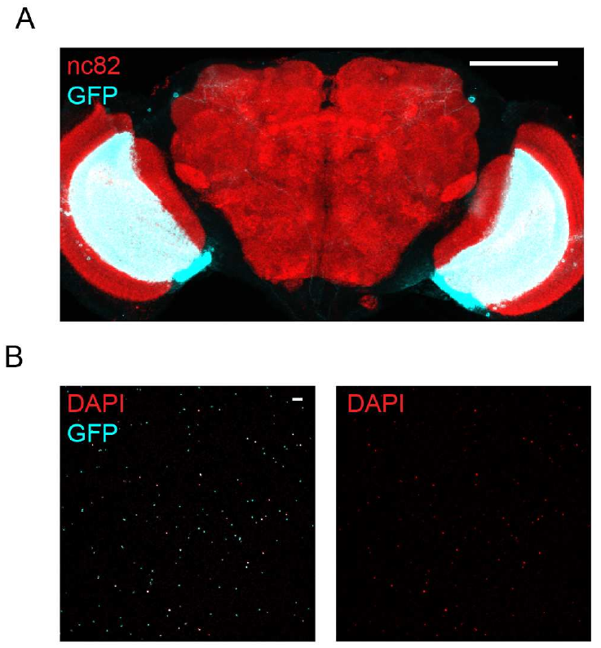
T4 and T5 express multiple receptor classes
A receptor is a protein through which a neuron detects a signal such as a neurotransmitter. An ionotropic receptor directly controls an ion channel; a metabotropic receptor acts through intracellular signaling. Either class can alter a neuron's integration of input.
Pankova and Borst isolated genetically labeled T4/T5 nuclei and used RNA sequencing to measure expressed transcripts. They detected nicotinic and muscarinic acetylcholine receptor transcripts, GABA receptor transcripts and the glutamate-gated chloride channel GluClα.
The published heat map reports RPKM, reads per kilobase of transcript per million mapped reads, on a 0–100 color scale. The assay pooled T4 and T5 and measured RNA, so each transcript reports expression in the combined population: it may occur in one class, in both or at different levels.
Pankova & Borst (2016), Fig. 3. Receptor transcripts quantified on the original expression scale.
Pankova & Borst (2016), Fig. 2(A, B). Labeled T4/T5 neurons and isolated nuclei.
Pankova & Borst (2016)
31
Notes:
• Nicotinic acetylcholine receptors are ionotropic, whereas muscarinic receptors signal through intracellular pathways. The expression of both categories permits several possible relationships between acetylcholine input and the receiving neuron's activity.
• Genetically labeled nuclei enriched the sample for T4 and T5. Sequencing then measured transcripts for receptor subunits rather than testing synaptic responses directly. The original color scale is a normalized expression measure, not a current amplitude.
• Pooling the two cell classes limits the interpretation. An expressed transcript may occur in one class, in both or at different levels, and an RNA result does not locate the resulting protein on a particular dendritic compartment.
References:
Pankova K, Borst A (2016). RNA-Seq Transcriptome Analysis of Direction-Selective T4/T5 Neurons in Drosophila. PLoS ONE 11:e0163986. https://doi.org/10.1371/journal.pone.0163986
Figure: Pankova & Borst (2016), Fig. 3. Receptor transcripts quantified on the original expression scale.
Figure source: https://doi.org/10.1371/journal.pone.0163986
Figure: Pankova & Borst (2016), Fig. 2(A, B). Labeled T4/T5 neurons and isolated nuclei.
Figure source: https://doi.org/10.1371/journal.pone.0163986

Slide 41
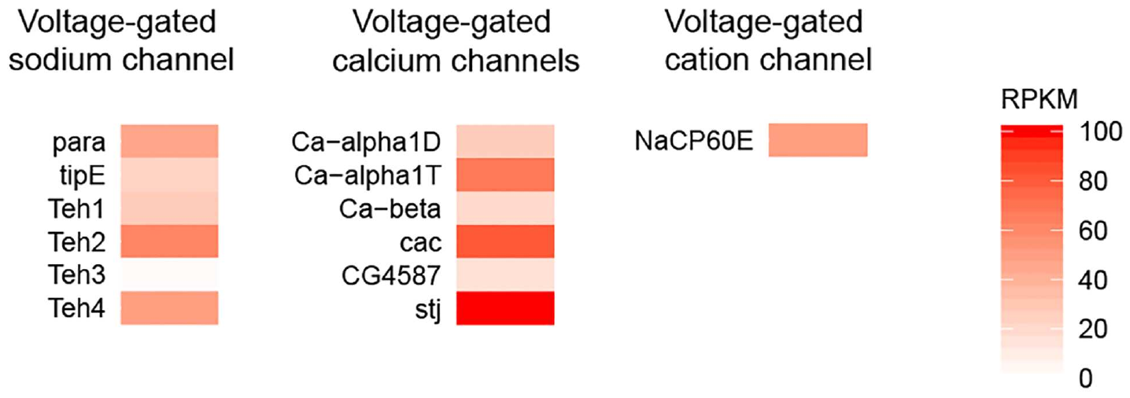
Sodium and calcium channels shape membrane signaling
A voltage-gated ion channel changes its opening probability with membrane potential, the electrical potential across the cell membrane. Such channels can transform synaptic input into different voltage and calcium responses instead of transmitting a passive copy of the input.
Pankova and Borst detected the sodium-channel gene para, four of its five identified auxiliary subunits, and transcripts for the identified voltage-gated calcium-channel subunits. They also detected NaCP60E, a cation channel permeable to sodium and calcium.
Channel expression provides molecular candidates for active processing and calcium entry in T4/T5. An auxiliary subunit can change how a channel behaves without forming the pore that carries the ions, so the detected para subunits and calcium-channel transcripts point to several ways membrane voltage can be transformed into calcium signals.
Pankova & Borst (2016), Fig. 4. Voltage-gated channel transcripts in pooled T4/T5 neurons.
Pankova & Borst (2016), Fig. 2(A, B). Labeled T4/T5 neurons and isolated nuclei.
Pankova & Borst (2016)
32
Notes:
• Voltage-gated means that the membrane potential affects channel opening. Sodium and calcium conductances can therefore change the relationship between input current, membrane voltage and intracellular calcium.
• The sequencing assay detected para together with several modulatory subunits and a range of calcium-channel transcripts. An auxiliary subunit can influence the behavior of a channel without itself defining the pore carrying the ions.
• The presence of the molecular components is evidence of capacity, not a recording of their use. Establishing action potentials or a particular delay mechanism requires electrical measurements and perturbation of the relevant channel, rather than an inference from RNA expression alone.
References:
Pankova K, Borst A (2016). RNA-Seq Transcriptome Analysis of Direction-Selective T4/T5 Neurons in Drosophila. PLoS ONE 11:e0163986. https://doi.org/10.1371/journal.pone.0163986
Figure: Pankova & Borst (2016), Fig. 4. Voltage-gated channel transcripts in pooled T4/T5 neurons.
Figure source: https://doi.org/10.1371/journal.pone.0163986
Figure: Pankova & Borst (2016), Fig. 2(A, B). Labeled T4/T5 neurons and isolated nuclei.
Figure source: https://doi.org/10.1371/journal.pone.0163986

Slide 42
Voltage-gated channels reshape voltage and calcium
A voltage-gated ion channel changes its opening probability as the membrane potential changes. The membrane response of a neuron with such channels is therefore not a passive copy of its synaptic input, because sodium and calcium conductances alter the relationship between input current, membrane voltage and intracellular calcium.
Pankova and Borst detected the sodium-channel gene para together with four of its five identified auxiliary subunits, transcripts for the identified voltage-gated calcium-channel subunits, and the cation channel NaCP60E. An auxiliary subunit influences how a channel behaves without itself forming the pore that carries the ions.
Potassium channels conduct potassium ions and change how membrane voltage evolves after excitation, so they influence how two inputs arriving at different times combine. Shaker, Shal and SK were among the strongly expressed candidates, and the authors proposed that such active conductances could contribute to delays and nonlinear interactions in motion detectors.
Pankova & Borst (2016), Fig. 4. Voltage-gated channel transcripts in pooled T4/T5 neurons.
Pankova & Borst (2016), Fig. 2(A, B). Labeled T4/T5 neurons and isolated nuclei.
Pankova & Borst (2016)
32a
Notes:
• Channel expression gives a list of molecular components that can shape how a T4 or T5 neuron integrates its inputs over time.
• Voltage gating.
– Because opening depends on membrane potential, a sodium or calcium conductance can amplify or reshape a depolarization and control calcium entry.
• Auxiliary subunits.
– The sequencing assay detected para with several modulatory subunits, and a subunit can change channel behavior without defining the pore.
• Potassium channels and temporal integration.
– Potassium conductances act after excitation, so their activation timing and the membrane conditions determine how an earlier input affects the response to a later one.
– The transcriptome included several potassium-channel families with different gating properties, which provides several candidate mechanisms for delay and nonlinearity.
• What the transcript list represents.
– The presence of the molecular components is evidence of capacity for active processing and calcium entry in T4/T5.
– Showing that these neurons use a particular channel, for example to produce a delay, requires electrical measurements and perturbation of that channel.
References:
Pankova K, Borst A (2016). RNA-Seq Transcriptome Analysis of Direction-Selective T4/T5 Neurons in Drosophila. PLoS ONE 11:e0163986. https://doi.org/10.1371/journal.pone.0163986

Slide 43
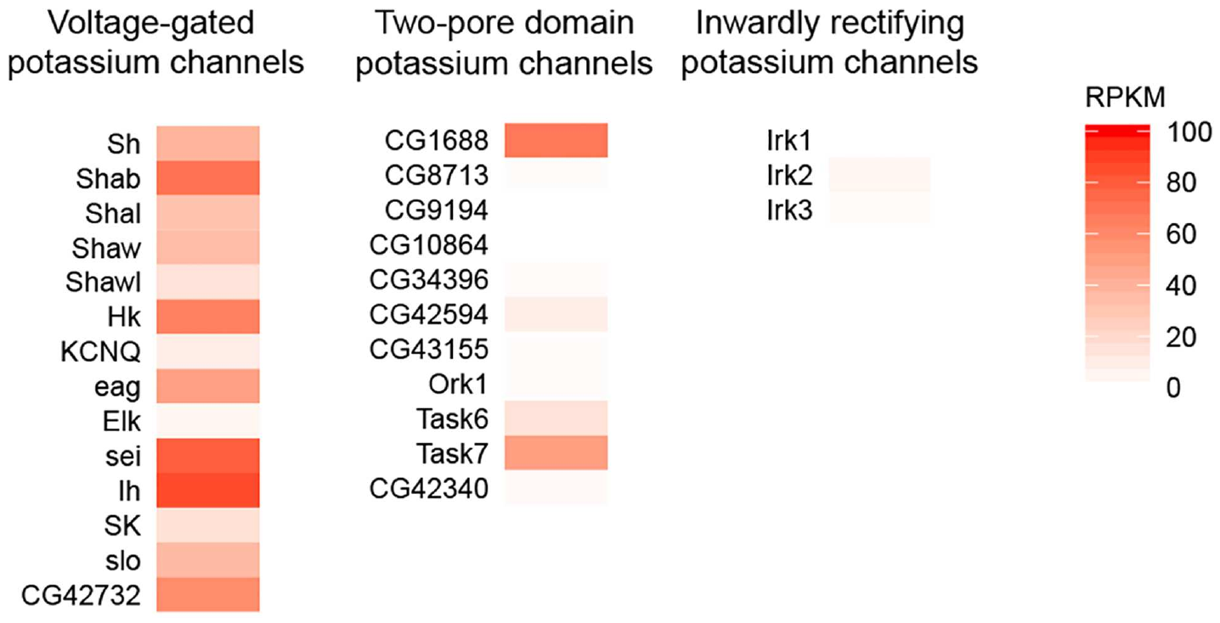
Potassium channels can regulate temporal integration
Potassium channels conduct potassium ions and can influence how membrane voltage evolves after excitation. Temporal integration is the combination of inputs over time; channel kinetics can alter the interval over which previous input affects a neuron's response.
Pankova and Borst detected transcripts for multiple voltage-gated and two-pore-domain potassium channels in pooled T4/T5 nuclei. Shaker, Shal and SK were among the strongly expressed candidates; inwardly rectifying potassium-channel transcripts were not detected in their assay.
The authors proposed that active membrane conductances could contribute to delays and nonlinear interactions within motion detectors. Potassium-channel families differ in their gating properties, so the expression list offers several candidate mechanisms for how an earlier input influences the response to a later one.
Pankova & Borst (2016), Fig. 5. Potassium-channel transcripts on the original RPKM scale.
Pankova & Borst (2016), Fig. 2(A, B). Labeled T4/T5 neurons and isolated nuclei.
Pankova & Borst (2016)
33
Notes:
• Potassium conductances can change membrane responses after excitation and therefore influence how two inputs arriving at different times combine. Their effect depends on when the channels activate and on the membrane conditions.
• The transcriptome included several potassium-channel families. The different categories have different gating properties, so the expression list offers multiple candidate mechanisms rather than one uniquely specified delay element.
• The paper uses the expression results to propose active dendritic processing. It does not selectively remove a channel and measure the resulting motion computation, so assigning the observed enhancement or suppression to Shaker, Shal or SK would go beyond the experiment.
References:
Pankova K, Borst A (2016). RNA-Seq Transcriptome Analysis of Direction-Selective T4/T5 Neurons in Drosophila. PLoS ONE 11:e0163986. https://doi.org/10.1371/journal.pone.0163986
Figure: Pankova & Borst (2016), Fig. 5. Potassium-channel transcripts on the original RPKM scale.
Figure source: https://doi.org/10.1371/journal.pone.0163986
Figure: Pankova & Borst (2016), Fig. 2(A, B). Labeled T4/T5 neurons and isolated nuclei.
Figure source: https://doi.org/10.1371/journal.pone.0163986

Slide 44
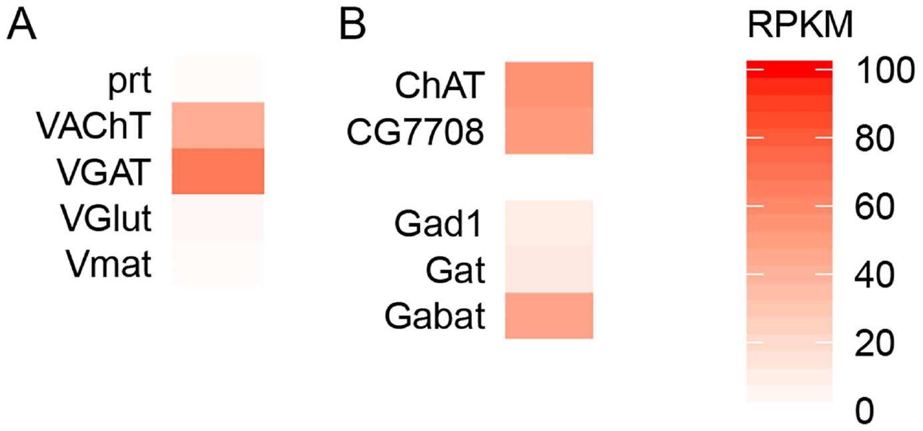
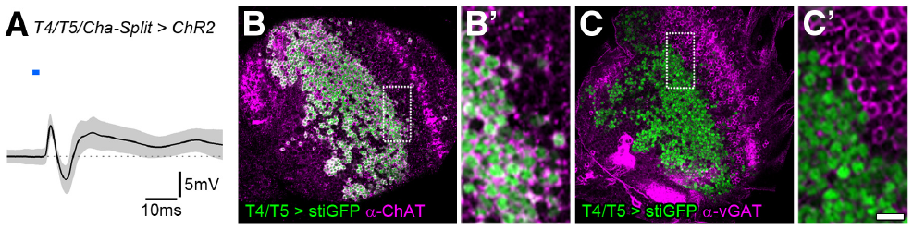
T4 and T5 have cholinergic transmitter machinery
A neuron's transmitter phenotype describes the chemical signaling machinery it uses. Choline acetyltransferase synthesizes acetylcholine, and the vesicular acetylcholine transporter packages it for synaptic release. Pankova and Borst detected transcripts for both in T4/T5.
Mauss and colleagues combined cell labeling with optogenetic stimulation and recordings from downstream lobula plate neurons. T4/T5 terminals labeled with the acetylcholine-synthesis marker, and selective activation of cholinergic T4/T5 produced rapid excitation followed by inhibition.
The transcriptome also detected vesicular GABA-transporter expression, a molecular hint of additional signaling. The physiological and pharmacological results support a primarily cholinergic output with an indirect inhibitory route, in which an intervening pathway supplies the inhibition instead of every T4/T5 terminal releasing an inhibitory transmitter directly.
Pankova & Borst (2016), Fig. 6. Transcripts for transmitter packaging and synthesis.
Mauss et al. (2014), Fig. 3. Physiology and transmitter-marker staining in T4/T5.
Pankova & Borst (2016); Mauss et al. (2014)
34
Notes:
• Transmitter identity can be assessed at several levels: RNA for synthetic and packaging proteins, antibody labeling of those proteins, and the response to selective stimulation plus receptor antagonists. Those assays should not be treated as interchangeable.
• The acetylcholine machinery appears in both transcriptomic and labeling evidence, and activating the cholinergic T4/T5 population drives a downstream response. This combination is stronger than assigning transmitter identity from a receptor transcript in the receiving cell.
• The GABA-transporter result raises a possibility but does not establish cotransmission. Direct inhibition would require evidence of inhibitory release from T4/T5 onto the recorded neuron, whereas the stimulation and pharmacology support an intervening inhibitory pathway.
References:
Pankova K, Borst A (2016). RNA-Seq Transcriptome Analysis of Direction-Selective T4/T5 Neurons in Drosophila. PLoS ONE 11:e0163986. https://doi.org/10.1371/journal.pone.0163986
Mauss AS, Meier M, Serbe E, Borst A (2014). Optogenetic and pharmacologic dissection of feedforward inhibition in Drosophila motion vision. Journal of Neuroscience 34:2254-2263. https://doi.org/10.1523/jneurosci.3938-13.2014
Figure: Pankova & Borst (2016), Fig. 6. Transcripts for transmitter packaging and synthesis.
Figure source: https://doi.org/10.1371/journal.pone.0163986
Figure: Mauss et al. (2014), Fig. 3. Physiology and transmitter-marker staining in T4/T5.
Figure source: https://doi.org/10.1523/jneurosci.3938-13.2014

Slide 45
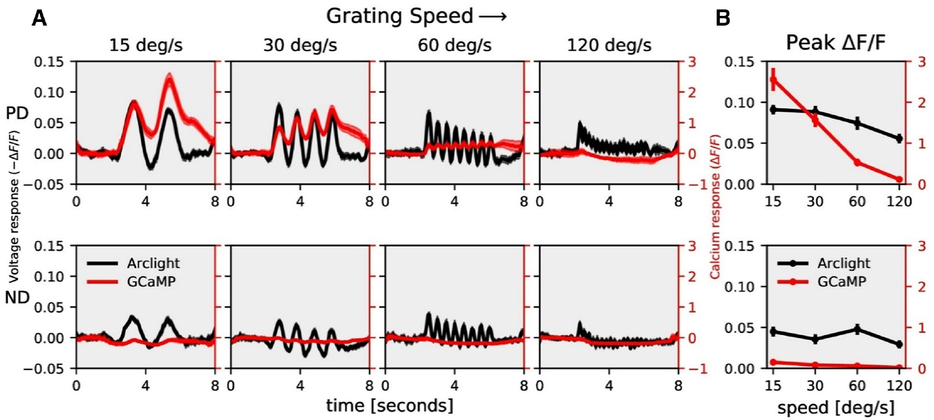
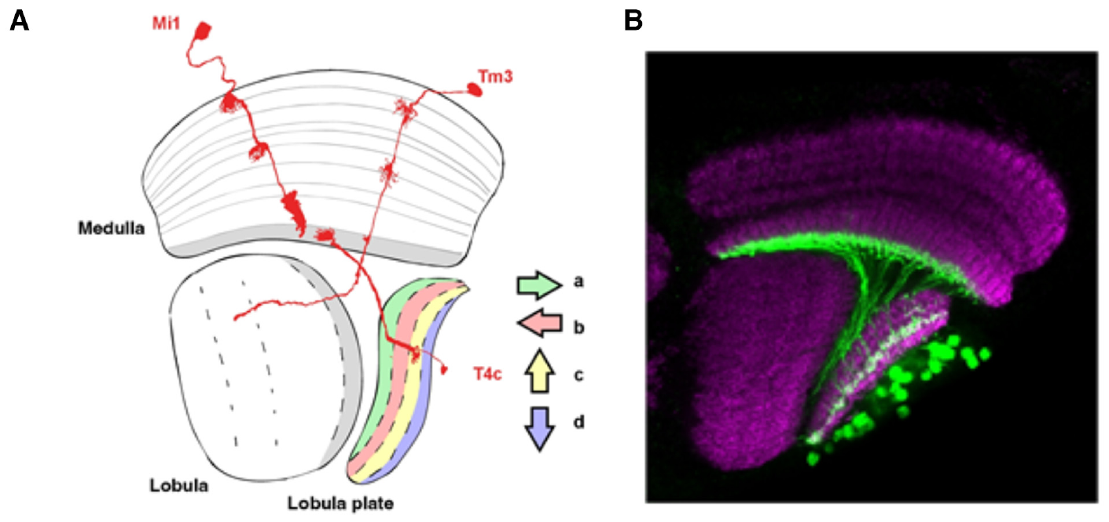
Calcium can sharpen voltage-based direction selectivity
ArcLight is a fluorescent voltage indicator; GCaMP6f reports intracellular calcium. Mishra and colleagues expressed them in T4c neurons, whose preferred direction is upward, and compared dendritic responses to the same visual stimulus set.
Gratings had wavelength 30° and moved at 15, 30, 60 or 120°/s. Voltage responses retained substantial null-direction activity, whereas calcium responses were more strongly biased toward the preferred direction. The difference was particularly pronounced at slower speeds.
The voltage-to-calcium transformation therefore contributes to measured direction selectivity rather than simply copying membrane voltage. Calcium-based estimates of the circuit's selectivity can exceed voltage-based estimates, so the selectivity read out in calcium is sharper than that of the voltage inputs from which it derives.
Mishra et al. (2023), Fig. 1(A, B). T4c anatomy.
Mishra et al. (2023), Fig. 2(A, B). ArcLight and GCaMP motion responses and their speed dependence.
Mishra et al. (2023)
35
Notes:
• ArcLight fluorescence decreases during depolarization, so the authors accounted for the indicator's sign when comparing it with calcium fluorescence. Both probes were targeted to the same T4 subtype and dendritic layer.
• The investigators used identical stimulus parameters across the indicator experiments. Preferred-direction voltage and calcium responses were strong, but the null-direction voltage response was much more apparent than the corresponding calcium response.
• The different selectivity follows from the transformation between electrical activity and calcium entry or handling. It also limits the inference from earlier calcium imaging: a highly selective fluorescent response does not mean that every underlying voltage input is equally selective.
References:
Mishra A, Serbe-Kamp E, Borst A, Haag J (2023). Voltage to Calcium Transformation Enhances Direction Selectivity in Drosophila T4 Neurons. Journal of Neuroscience 43:2497-2514. https://doi.org/10.1523/jneurosci.2297-22.2023
Figure: Mishra et al. (2023), Fig. 2(A, B). ArcLight and GCaMP motion responses and their speed dependence.
Figure source: https://doi.org/10.1523/jneurosci.2297-22.2023
Figure: Mishra et al. (2023), Fig. 1(A, B). T4c anatomy.
Figure source: https://doi.org/10.1523/jneurosci.2297-22.2023

Slide 46
Calcium is a transformed readout of membrane voltage
ArcLight is a fluorescent voltage indicator whose fluorescence decreases during depolarization, and GCaMP6f reports intracellular calcium. Mishra and colleagues expressed each in T4c neurons, which prefer upward motion, and presented identical gratings with a 30° wavelength moving at 15, 30, 60 or 120°/s.
Both signals responded strongly to the preferred direction, but the null-direction voltage response was much more apparent than the corresponding calcium response, particularly at slower speeds. The calcium signal therefore reported a more direction-selective response than the membrane voltage that produced it.
The difference follows from the transformation between electrical activity and calcium entry or handling, so selectivity measured with calcium indicators is sharper than the selectivity of the voltage inputs from which it derives. The synaptic computation of direction and the voltage-to-calcium step are separate contributions within T4.
Mishra et al. (2023), Fig. 1(A, B). T4c anatomy.
Mishra et al. (2023), Fig. 2(A, B). ArcLight and GCaMP motion responses and their speed dependence.
Mishra et al. (2023)
35a
Notes:
• The activity variable that an indicator reports can change how selective a neuron appears.
• Two indicators in one cell type.
– ArcLight fluorescence decreases during depolarization, so the authors accounted for its sign when comparing it with calcium fluorescence.
– Both probes were targeted to T4c in the same dendritic layer, with identical stimulus parameters across the experiments.
• The comparison.
– Preferred-direction voltage and calcium responses were strong in both cases.
– Null-direction activity was much more apparent in the voltage signal than in the calcium signal.
• Reading the difference.
– Calcium reflects entry and handling of calcium downstream of voltage, so selectivity estimated from calcium imaging can exceed selectivity in the membrane voltage.
– The comparison pairs two labeled preparations, one for each indicator.
• Why this changes how earlier imaging is read.
– A highly selective fluorescent calcium response does not mean that every underlying voltage input is equally selective.
– The direction computation produced by the synaptic inputs and the later voltage-to-calcium step are two contributions that coexist within T4.
References:
Mishra A, Serbe-Kamp E, Borst A, Haag J (2023). Voltage to Calcium Transformation Enhances Direction Selectivity in Drosophila T4 Neurons. Journal of Neuroscience 43:2497-2514. https://doi.org/10.1523/jneurosci.2297-22.2023

Slide 47
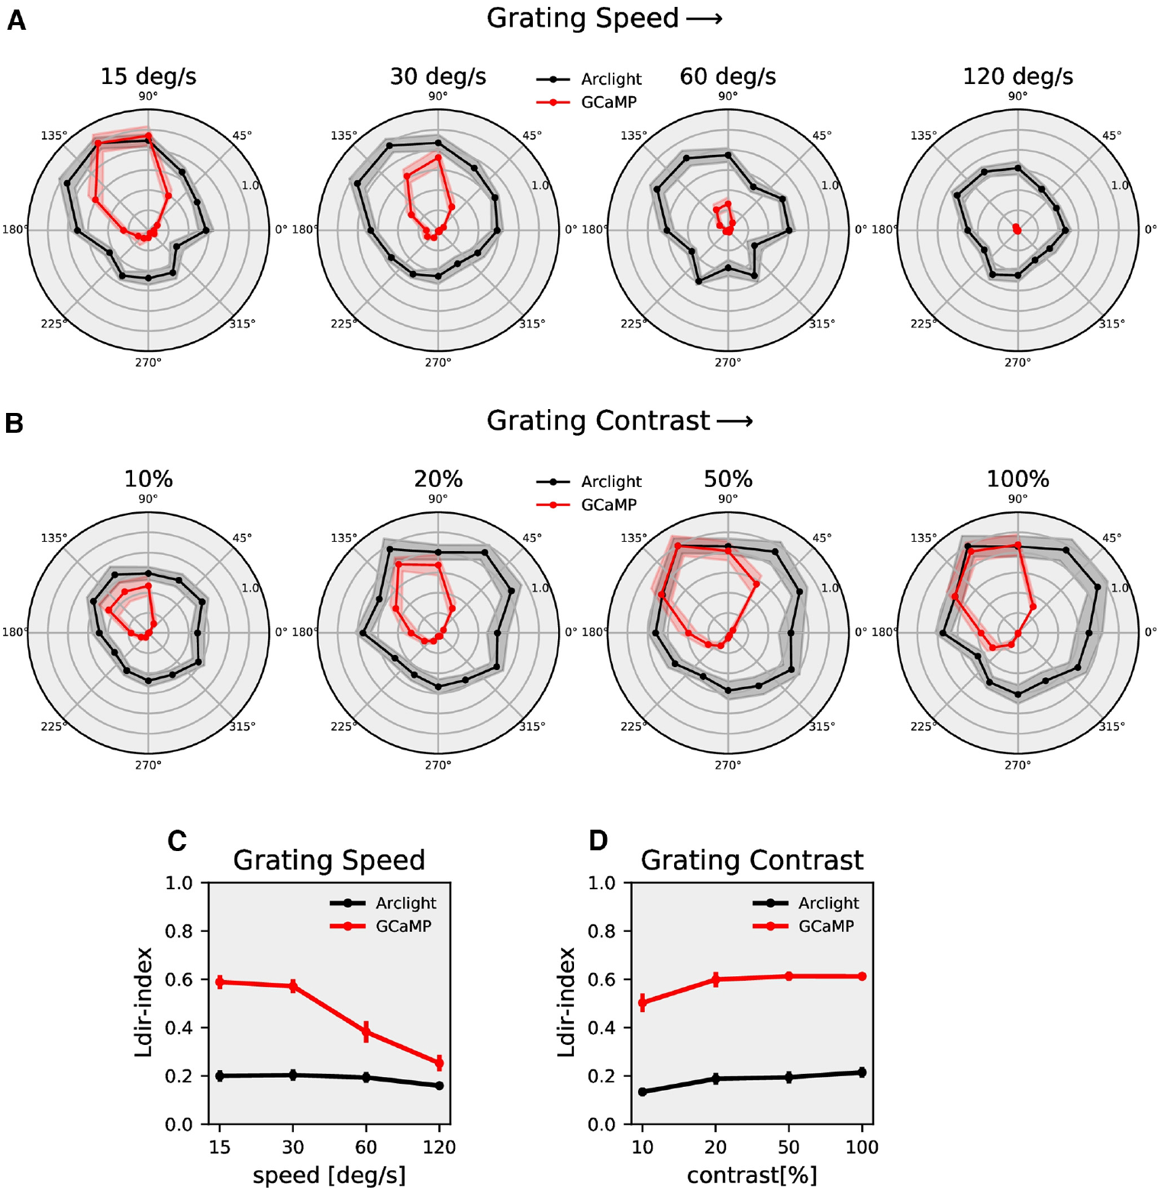
Calcium signals differ from synaptic computations
A neuron's directional tuning is its response across motion directions. Mishra and colleagues measured T4c responses to gratings moving in 12 directions, across four speeds and contrasts from 10% to 100%, using voltage and calcium indicators.
Calcium tuning was narrower and more direction-selective than voltage tuning under the tested conditions. Both signals changed with speed and contrast, but their relative sensitivity differed. The readout is therefore part of the experimentally observed transformation from visual input to neural output.
The authors compared published filtering and nonlinear-transform models with the measurements, and models containing temporal filtering and a nonlinear step captured how voltage maps onto calcium. Synaptic direction computation and the later voltage-to-calcium transformation are distinct contributions that can coexist within T4.
Mishra et al. (2023), Fig. 1(A, B). T4c anatomy.
Mishra et al. (2023), Fig. 4. Voltage and calcium directional tuning across speed and contrast.
Mishra et al. (2023)
36
Notes:
• Testing twelve directions distinguishes tuning width from the simple preferred-versus-null comparison. A neuron may respond weakly to its exact null direction yet still respond broadly to other directions.
• The calcium response was more selective than the voltage response over the tested stimulus set, and the difference depended on speed and contrast. The properties of the activity variable measured therefore affect the apparent strength of selectivity.
• The fitted transformations contain temporal filtering and nonlinear operations. Their agreement with the data is an input-output account, whereas selecting a specific calcium channel as the cause would require additional molecular and physiological experiments.
References:
Mishra A, Serbe-Kamp E, Borst A, Haag J (2023). Voltage to Calcium Transformation Enhances Direction Selectivity in Drosophila T4 Neurons. Journal of Neuroscience 43:2497-2514. https://doi.org/10.1523/jneurosci.2297-22.2023
Figure: Mishra et al. (2023), Fig. 4. Voltage and calcium directional tuning across speed and contrast.
Figure source: https://doi.org/10.1523/jneurosci.2297-22.2023
Figure: Mishra et al. (2023), Fig. 1(A, B). T4c anatomy.
Figure source: https://doi.org/10.1523/jneurosci.2297-22.2023

Slide 48
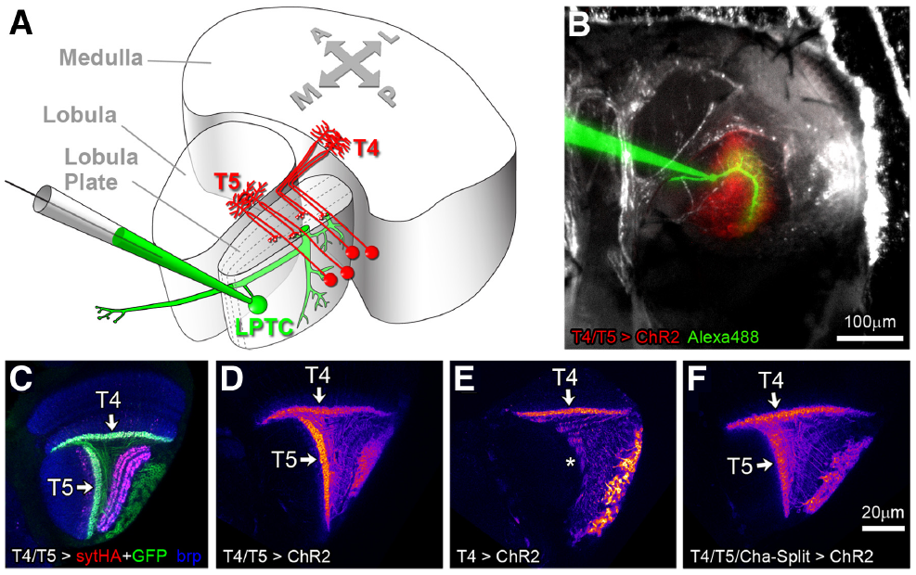
Lobula plate neurons pool many local motion signals
Lobula plate tangential cells, or LPTCs, extend dendrites across many local motion channels. Spatial pooling combines activity from multiple visual locations, allowing these neurons to represent broad optic-flow patterns rather than only one neighboring pair of inputs.
Schnell and colleagues recorded horizontal-system and vertical-system cells, which favor horizontal and vertical flow components. Blocking T4/T5 output removed motion-dependent voltage responses while leaving responses to brightness flicker. The wide-field directional signal therefore depends on the local detector population.
Mauss and colleagues labeled T4/T5 terminals together with recorded LPTCs, relating the input population to its downstream targets. Pooling changes the spatial scale of the signal: a local detector evaluates motion over a restricted part of the visual field, whereas a tangential cell's response reflects a broad distribution of motion across the eye.
Schnell et al. (2012), Fig. 2. Motion responses disappear while flicker responses persist.
Mauss et al. (2014), Fig. 1(A–F). Local motion neurons contact lobula plate tangential cells.
Schnell et al. (2012); Mauss et al. (2014)
37
Notes:
• A local detector evaluates motion over a restricted part of the visual field. A tangential cell samples many such outputs, so the resulting response can reflect a broad distribution of motion across the eye.
• Horizontal-system and vertical-system neurons are wide-field cells with different preferred flow components. Their motion responses depend on T4/T5 transmission, whereas retained flicker responses provide a control against complete visual or recording failure.
• Contact tracing and labeling connect the local detector population to the wide-field cell. They do not establish the full motor pathway: a cell's response to optic flow can provide a steering signal without determining every detail of the eventual movement.
References:
Schnell B, Raghu SV, Nern A, Borst A (2012). Columnar cells necessary for motion responses of wide-field visual interneurons in Drosophila. Journal of Comparative Physiology A 198:389-395. https://doi.org/10.1007/s00359-012-0716-3
Mauss AS, Meier M, Serbe E, Borst A (2014). Optogenetic and pharmacologic dissection of feedforward inhibition in Drosophila motion vision. Journal of Neuroscience 34:2254-2263. https://doi.org/10.1523/jneurosci.3938-13.2014
Figure: Schnell et al. (2012), Fig. 2. Motion responses disappear while flicker responses persist.
Figure source: https://doi.org/10.1007/s00359-012-0716-3
Figure: Mauss et al. (2014), Fig. 1(A–F). Local motion neurons contact lobula plate tangential cells.
Figure source: https://doi.org/10.1523/jneurosci.3938-13.2014

Slide 49
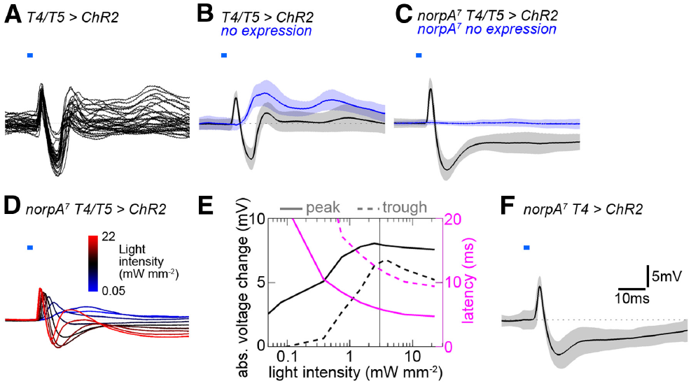
T4 and T5 activation excites tangential cells
Optogenetics uses a light-sensitive protein to manipulate selected neurons. Mauss and colleagues expressed channelrhodopsin-2, a light-gated cation channel, in T4/T5 and recorded downstream LPTC membrane voltage during 2-ms blue-light pulses.
Selective activation produced a fast depolarizing peak at approximately 5.4 ms followed by an inhibitory trough near 11 ms. Depolarization makes membrane potential less negative; hyperpolarization makes it more negative. These response components have different timing despite the same initiating stimulus.
Flies lacking channelrhodopsin provided a light-stimulation control, and visually blind norpA preparations reduced contamination from ordinary retinal responses. The experiments establish a rapid excitatory route from T4/T5 to LPTCs; the later inhibitory component requires an additional explanation rather than a second assumed direct transmitter action.
Mauss et al. (2014), Fig. 2. Brief optogenetic pulses evoke fast excitation and delayed inhibition.
Mauss et al. (2014), Fig. 1(A–F). Labeled T4/T5 inputs and the recorded tangential cell.
Mauss et al. (2014)
38
Notes:
• Channelrhodopsin allows the investigator to activate genetically selected cells without relying on the visual stimulus that normally drives them. The blue pulse initiates activity in T4/T5, and the downstream electrode measures the resulting membrane response.
• The fast peak preceded the inhibitory trough by several milliseconds. These are response peak times under the pulse protocol, not the delay fitted for the behavioral Reichardt model.
• A control without the light-sensitive protein identifies effects of the flash itself. The norpA blind preparation further separates optogenetic activation from phototransduction. Together the controls strengthen the assignment of the recorded response to T4/T5 transmission.
References:
Mauss AS, Meier M, Serbe E, Borst A (2014). Optogenetic and pharmacologic dissection of feedforward inhibition in Drosophila motion vision. Journal of Neuroscience 34:2254-2263. https://doi.org/10.1523/jneurosci.3938-13.2014
Figure: Mauss et al. (2014), Fig. 2. Brief optogenetic pulses evoke fast excitation and delayed inhibition.
Figure source: https://doi.org/10.1523/jneurosci.3938-13.2014
Figure: Mauss et al. (2014), Fig. 1(A–F). Labeled T4/T5 inputs and the recorded tangential cell.
Figure source: https://doi.org/10.1523/jneurosci.3938-13.2014

Slide 50
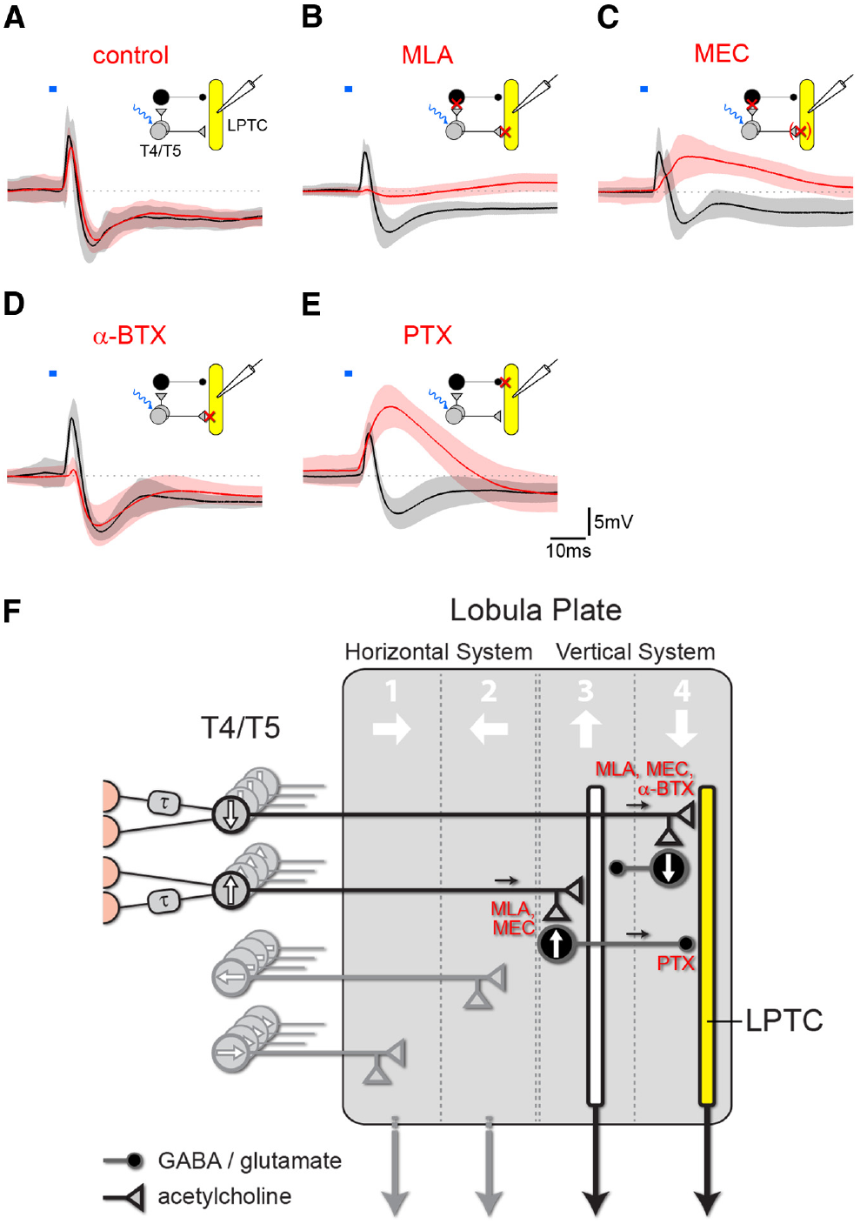
Feedforward inhibition supplies opposite-direction signals
Feedforward inhibition occurs when an upstream neuron activates an intervening inhibitory neuron that suppresses a downstream target. Mauss and colleagues combined T4/T5 optogenetic stimulation with antagonists, drugs that reduce signaling through particular receptor classes.
Blocking nicotinic acetylcholine receptors with methyllycaconitine strongly reduced both response components. α-Bungarotoxin preferentially reduced fast excitation, whereas picrotoxin removed inhibition and increased excitation. The different profiles support direct cholinergic excitation plus an indirectly recruited inhibitory route.
Picrotoxin at 25 µM reduced responses to pressure-applied glutamate as well as GABA, so the inhibitory conductance in the indirect route could be GABAergic, glutamatergic or both. Different sensitivities to the cholinergic antagonists are consistent with different receptor populations on the direct and indirect routes.
Mauss et al. (2014), Fig. 5(A–F). Pharmacology and the published feedforward circuit.
Mauss et al. (2014)
39
Notes:
• Nicotinic acetylcholine receptors are ligand-gated ion channels through which acetylcholine can directly excite a receiving neuron. Blocking cholinergic activation can suppress both the direct target and an inhibitory neuron activated upstream of it.
• The loss of inhibition after picrotoxin, together with enhanced remaining excitation, supports an inhibitory conductance opposing the fast excitatory response. Different sensitivities to the cholinergic antagonists are consistent with different receptor populations on the direct and indirect routes.
• The drug controls limit transmitter specificity. Picrotoxin affected glutamate-evoked inhibition as well as GABA-evoked inhibition, so assigning the entire indirect pathway to GABA on that drug result alone would be unjustified.
References:
Mauss AS, Meier M, Serbe E, Borst A (2014). Optogenetic and pharmacologic dissection of feedforward inhibition in Drosophila motion vision. Journal of Neuroscience 34:2254-2263. https://doi.org/10.1523/jneurosci.3938-13.2014
Figure: Mauss et al. (2014), Fig. 5(A–F). Pharmacology and the published feedforward circuit.
Figure source: https://doi.org/10.1523/jneurosci.3938-13.2014

Slide 51
Feedforward inhibition adds a delayed opposing signal
Feedforward inhibition occurs when an upstream neuron excites an intervening inhibitory neuron that suppresses a downstream target. The upstream neuron therefore drives its target through two routes at once: a direct excitatory route and an indirect inhibitory route.
Mauss and colleagues activated T4/T5 with brief blue-light pulses and recorded the tangential-cell response, which began with a fast depolarizing peak at approximately 5.4 ms followed by an inhibitory trough near 11 ms. An indirect route adds an intervening neuron and an extra synaptic step, which is consistent with the later arrival of the inhibition.
Antagonists separated the two routes. Methyllycaconitine strongly reduced both components, α-bungarotoxin preferentially reduced the fast excitation, and picrotoxin removed the inhibition and increased the excitation, as expected if an inhibitory conductance normally opposes the direct excitatory response.
Mauss et al. (2014), Fig. 5(A–F). Pharmacology and the published feedforward circuit.
Mauss et al. (2014)
39a
Notes:
• Feedforward inhibition gives a neuron an excitatory and an inhibitory input that originate from the same source and arrive at different times.
• Two routes from T4/T5.
– The direct route excites the tangential cell through nicotinic acetylcholine receptors.
– The indirect route recruits an inhibitory neuron whose action opposes the direct excitation.
• Timing separates the routes.
– The excitatory peak preceded the inhibitory trough by several milliseconds, and the inhibitory route includes an additional intervening neuron.
– These are response peak times under the pulse protocol, distinct from the delay fitted in the behavioral Reichardt model.
• Drugs separate the receptor classes.
– Methyllycaconitine blocks nicotinic receptors and reduced both components, which fits blocking the direct target together with the upstream activation of the inhibitory neuron.
– Different sensitivities to the cholinergic antagonists are consistent with different receptor populations on the direct and indirect routes.
– Picrotoxin reduced the inhibition and left more excitation, which indicates an inhibitory conductance opposing the fast response.
References:
Mauss AS, Meier M, Serbe E, Borst A (2014). Optogenetic and pharmacologic dissection of feedforward inhibition in Drosophila motion vision. Journal of Neuroscience 34:2254-2263. https://doi.org/10.1523/jneurosci.3938-13.2014

Slide 52
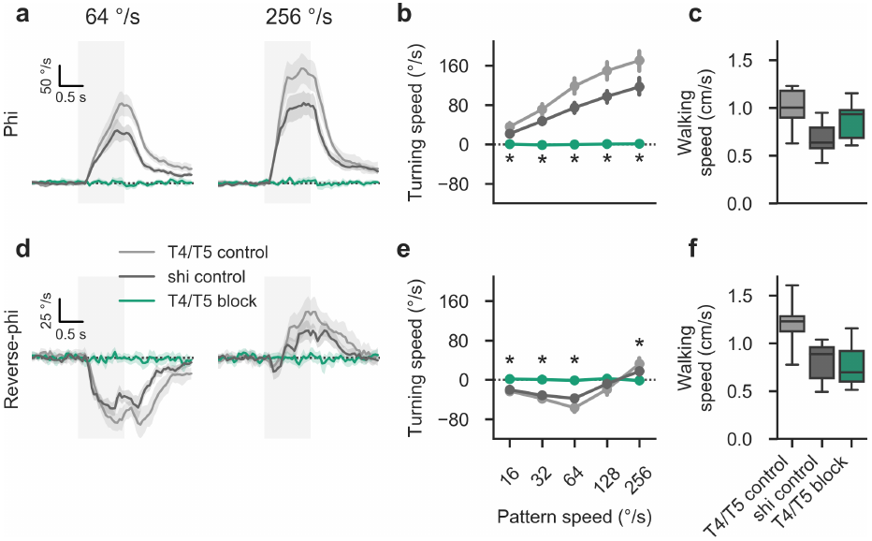
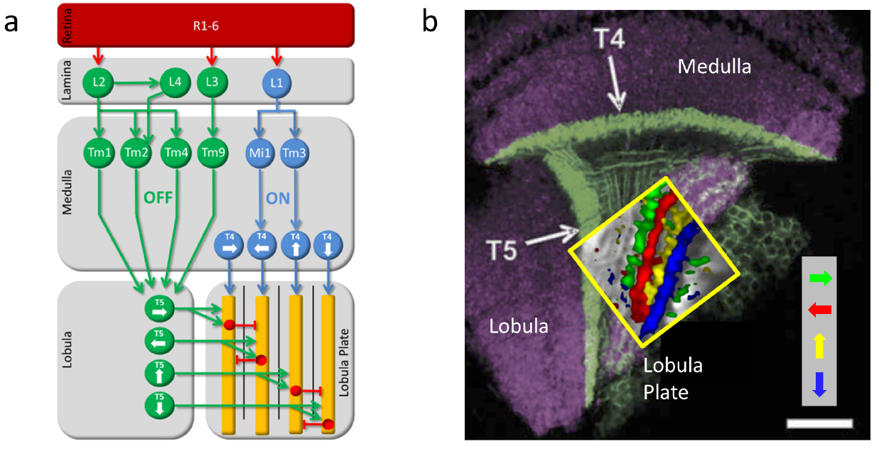
Reverse-phi turning requires T4 and T5
A motion illusion can use the same early circuit as an ordinary stabilizing response. Leonhardt and colleagues suppressed T4/T5 synaptic output and measured turning during phi and reverse-phi stimulation in tethered walking flies.
Control flies turned with ordinary motion and against slower reverse-phi motion. T4/T5-blocked flies lost both responses, including the high-velocity re-inversion of reverse-phi turning. Genetic controls retained directional responses under the same test conditions.
Forward walking speed remained comparable across the tested genotypes. The behavioral deficit therefore was not explained by an inability to walk. T4/T5 are necessary for these directional responses, and because the same silencing removed both ordinary and illusory turning, the illusion draws on the same early motion circuit as ordinary stabilizing turns.
Leonhardt et al. (2017), Fig. 4. T4/T5 silencing removes turning but preserves walking.
Haag et al. (2016), Fig. 1(a, b). Local ON and OFF pathway anatomy.
Leonhardt et al. (2017); Haag et al. (2016)
40
Notes:
• The same silencing manipulation affected both ordinary and illusory motion responses. That shared dependence makes a separate route bypassing T4/T5 unnecessary for the tested reverse-phi behavior.
• The controls retained the velocity-dependent reversals, while the combined T4/T5 block abolished turning responses across those conditions. The manipulation targeted output from the local detector population rather than measuring a model prediction alone.
• Comparable forward walking is a motor control with a specific scope. It argues against general locomotor failure but does not prove that every motor function is unaffected, and it does not distinguish the individual contributions of T4 and T5.
References:
Leonhardt A, Meier M, Serbe E, Eichner H, Borst A (2017). Neural mechanisms underlying sensitivity to reverse-phi motion in the fly. PLoS ONE 12:e0189019. https://doi.org/10.1371/journal.pone.0189019
Haag J, Arenz A, Serbe E, Gabbiani F, Borst A (2016). Complementary mechanisms create direction selectivity in the fly. eLife 5:e17421. https://doi.org/10.7554/elife.17421
Figure: Leonhardt et al. (2017), Fig. 4. T4/T5 silencing removes turning but preserves walking.
Figure source: https://doi.org/10.1371/journal.pone.0189019
Figure: Haag et al. (2016), Fig. 1(a, b). Local ON and OFF pathway anatomy.
Figure source: https://doi.org/10.7554/elife.17421

Slide 53
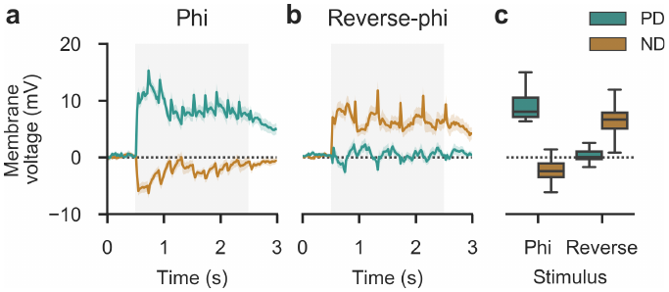
Tangential cells can encode an illusory direction
A patch-clamp recording measures electrical activity through an electrode contacting a neuronal membrane. Leonhardt and colleagues recorded tangential-cell voltage during phi and reverse-phi gratings with wavelength 45°, speed 128°/s and step width 6°.
Ordinary preferred-direction motion depolarized the cells, and ordinary null-direction motion hyperpolarized them. Reverse-phi displaced in the null direction instead produced depolarization, though weaker than the ordinary preferred-direction response. Reverse-phi displaced in the preferred direction produced little detectable voltage deflection.
The neuronal response therefore partially inverted with the illusion rather than reproducing the ordinary response with its sign flipped at every stage. Direct voltage recordings distinguish active hyperpolarization from a response near baseline, which a calcium signal near zero cannot do. The agreement between neural and behavioral direction supports an early sensory contribution to the illusory turn.
Leonhardt et al. (2017), Fig. 5. Patch-clamp responses to phi and reverse-phi motion.
Mauss et al. (2014), Fig. 1(A–F). Lobula plate inputs and tangential-cell anatomy.
Leonhardt et al. (2017); Mauss et al. (2014)
41
Notes:
• Voltage recordings can resolve opposite electrical response signs. A calcium measurement near baseline cannot by itself distinguish lack of excitation from active hyperpolarization.
• The same tangential-cell preparation was tested with both stimulus types and both directions. Ordinary motion produced the expected depolarizing and hyperpolarizing responses, but contrast reversal changed the response to a physically null-direction displacement.
• The inversion was incomplete: reverse-phi preferred-direction displacement did not simply reproduce a strong null-direction hyperpolarization. That asymmetry is a constraint on the circuit mechanism and prevents the illusion from being described as a perfect sign reversal at every neural stage.
References:
Leonhardt A, Meier M, Serbe E, Eichner H, Borst A (2017). Neural mechanisms underlying sensitivity to reverse-phi motion in the fly. PLoS ONE 12:e0189019. https://doi.org/10.1371/journal.pone.0189019
Mauss AS, Meier M, Serbe E, Borst A (2014). Optogenetic and pharmacologic dissection of feedforward inhibition in Drosophila motion vision. Journal of Neuroscience 34:2254-2263. https://doi.org/10.1523/jneurosci.3938-13.2014
Figure: Leonhardt et al. (2017), Fig. 5. Patch-clamp responses to phi and reverse-phi motion.
Figure source: https://doi.org/10.1371/journal.pone.0189019
Figure: Mauss et al. (2014), Fig. 1(A–F). Lobula plate inputs and tangential-cell anatomy.
Figure source: https://doi.org/10.1523/jneurosci.3938-13.2014

Slide 54
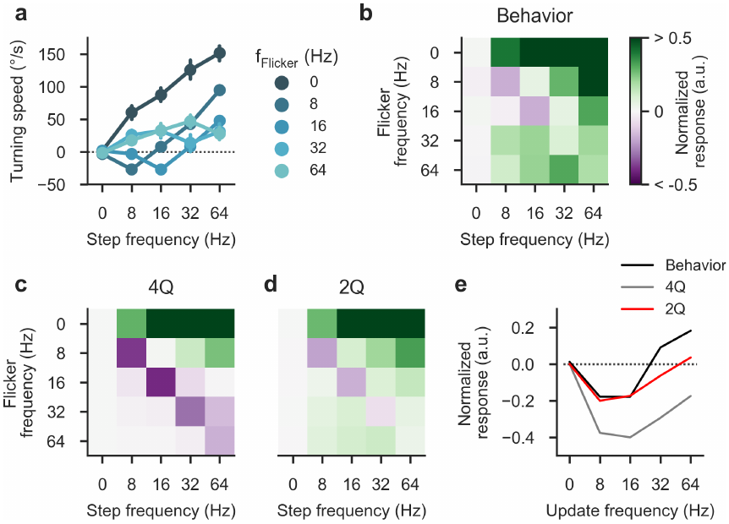

Bright and dark motion pathways can interact
Rectification preferentially retains one sign of an input signal. A motion model that completely rectifies bright and dark signals into independent channels can lose the cross-polarity interactions required for reverse-phi responses. Separate ON and OFF pathways therefore need a more precise computational description.
Leonhardt and colleagues varied flicker frequency independently of spatial-step frequency. Behavioral responses changed with both, constraining explanations based only on physical displacement. A published two-quadrant model including a constant-luminance component captured important features of the measured reversal.
The two-quadrant model included a baseline luminance contribution, which allows effective opposite-polarity influences without multiplying every ON and OFF pair directly. Clark's polarity tests and Leonhardt's dissociated stimuli both require sensitivity beyond two isolated, perfectly rectified streams, and anatomical ON/OFF separation remains compatible with functional influence from both contrast signs.
Leonhardt et al. (2017), Fig. 9. Measured responses and published detector predictions.
Leonhardt et al. (2017), Fig. 6. Published four- and two-quadrant computational accounts.
Leonhardt et al. (2017); Clark et al. (2011)
42
Notes:
• Rectification means retaining or emphasizing one sign after a signal transformation. Complete removal of the opposite sign can prevent a model from responding to contrast-reversing sequences in the way that flies do.
• Separately controlling flicker and spatial displacement tested whether response direction depended on the temporal contrast events as well as the steps. The resulting response map supplied more constraints than one ordinary-versus-reverse comparison.
• The two-quadrant model included a baseline luminance contribution, allowing effective opposite-polarity influences without requiring direct multiplication of every ON and OFF pair. Its fit is a proposed computational account; it does not identify the cellular origin of that baseline term.
References:
Leonhardt A, Meier M, Serbe E, Eichner H, Borst A (2017). Neural mechanisms underlying sensitivity to reverse-phi motion in the fly. PLoS ONE 12:e0189019. https://doi.org/10.1371/journal.pone.0189019
Clark DA, Bursztyn L, Horowitz MA, Schnitzer MJ, Clandinin TR (2011). Defining the computational structure of the motion detector in Drosophila. Neuron 70:1165-1177. https://doi.org/10.1016/j.neuron.2011.05.023
Figure: Leonhardt et al. (2017), Fig. 9. Measured responses and published detector predictions.
Figure source: https://doi.org/10.1371/journal.pone.0189019
Figure: Leonhardt et al. (2017), Fig. 6. Published four- and two-quadrant computational accounts.
Figure source: https://doi.org/10.1371/journal.pone.0189019

Slide 55
Rectification removes cross-polarity interactions
Rectification retains or emphasizes one sign of a signal after a transformation. A motion model that rectifies bright and dark signals completely into two independent channels removes the interactions between a brightness increase at one position and a decrease at its neighbor.
Reverse-phi stimuli consist of such cross-polarity sequences, because each displacement swaps bright and dark regions. A detector built only from separate, fully rectified ON and OFF streams would lose the interactions that reverse-phi responses require, so the behavior needs sensitivity beyond two isolated channels.
Leonhardt and colleagues varied flicker frequency independently of spatial-step frequency, and behavioral responses changed with both. A published two-quadrant model that includes a constant-luminance component captured important features of the measured reversal.
Leonhardt et al. (2017), Fig. 9. Measured responses and published detector predictions.
Leonhardt et al. (2017), Fig. 6. Published four- and two-quadrant computational accounts.
Leonhardt et al. (2017); Clark et al. (2011)
42a
Notes:
• Rectification explains why separating bright and dark pathways anatomically does not make them functionally independent.
• What rectification does.
– It keeps one sign of the signal, so a fully rectified channel responds to its preferred contrast change and ignores the opposite one.
– Two fully rectified channels cannot form products between a brightness increase and a decrease.
• The stimulus that exposes the problem.
– In reverse-phi each displacement swaps bright and dark, so neighboring signals have opposite polarities.
– Flies still respond, which requires effective cross-polarity sensitivity.
• The two-quadrant account.
– Adding a baseline luminance contribution allows opposite-polarity influences to enter without a direct multiplier on every ON and OFF pair.
– Clark's four polarity pairings and Leonhardt's dissociated flicker and step frequencies both require this sensitivity, and anatomical ON and OFF separation remains compatible with it.
• What the model fit represents.
– The model is a proposed computational account of effective pathway interactions, and the baseline term is a constant-luminance component in the model.
– The cellular origin of that baseline contribution is a separate question for physiological experiments.
References:
Leonhardt A, Meier M, Serbe E, Eichner H, Borst A (2017). Neural mechanisms underlying sensitivity to reverse-phi motion in the fly. PLoS ONE 12:e0189019. https://doi.org/10.1371/journal.pone.0189019
Clark DA, Bursztyn L, Horowitz MA, Schnitzer MJ, Clandinin TR (2011). Defining the computational structure of the motion detector in Drosophila. Neuron 70:1165-1177. https://doi.org/10.1016/j.neuron.2011.05.023

Slide 56

Sustained high contrast can reverse optomotor turning
Reverse-phi changes stimulus contrast sign between frames. Anti-directional turning in Mano's experiments occurred during continuously drifting sinusoidal gratings without such contrast reversals, so the two behavioral reversals have different stimulus definitions.
With wavelength 60°, temporal frequency 1 Hz and contrast 1.0, flies initially turned with the pattern and then against it after approximately 1–2 s. At contrast 0.25, the turn remained aligned with the stimulus. The pattern's physical motion did not reverse.
Spatial and temporal tuning also differed between the initial 0.5-s response and the later 1–4-s response, so a measurement averaged over the whole stimulus would hide the dynamics. Because the external motion never reversed, the change in turning direction arises from processing within the fly, through downstream dynamics or adaptation.
Mano et al. (2023), Fig. 2(a, b). Early and late turning differ across spatial and temporal frequency.
Mano et al. (2023), Fig. 1(b, c). Turning changes sign during an unchanged high-contrast stimulus.
Mano et al. (2023)
43
Notes:
• The anti-directional response used an ordinary drifting grating. Its contrast remained defined in the same way over time, unlike reverse-phi, where the bright and dark regions swap at each displacement.
• High contrast produced a delayed change in turning direction, while lower contrast produced sustained turning with the pattern. Because the external motion remained unchanged, the time dependence arises in the animal's processing or response rather than from a reversal of the stimulus.
• Comparing early and late response maps reveals different tuning. A single measurement averaged over the whole stimulus would hide those dynamics and could mischaracterize the direction and strength of the optomotor response.
References:
Mano O, Choi M, Tanaka R, Creamer MS, Matos NCB, Shomar JW, Badwan BA, Clandinin TR, Clark DA (2023). Long-timescale anti-directional rotation in <i>Drosophila</i> optomotor behavior. eLife 12:e86076. https://doi.org/10.7554/elife.86076
Figure: Mano et al. (2023), Fig. 2(a, b). Early and late turning differ across spatial and temporal frequency.
Figure source: https://doi.org/10.7554/elife.86076
Figure: Mano et al. (2023), Fig. 1(b, c). Turning changes sign during an unchanged high-contrast stimulus.
Figure source: https://doi.org/10.7554/elife.86076

Slide 57

Behavioral reversals need not originate in T4 or T5
A neuron can be necessary for a behavior without generating every temporal transformation within that behavior. Mano and colleagues silenced T4/T5 and eliminated both ordinary and delayed anti-directional turning during the tested gratings.
Calcium imaging of T4, T5 and several lobula plate cell classes did not reveal a reversal or decay matching the behavioral switch. Preferred-direction signals persisted over the interval in which the fly's turn changed sign; null-direction activity remained comparatively weak.
The results support a transformation downstream of the sampled lobula plate signals. Silencing establishes that detector output is required for both the early and the late turn, whereas the imaging places the sign change beyond the detector: preferred-direction signals persisted while the behavior inverted.
Mano et al. (2023), Fig. 5(a–e). T4, T5, HS and CH responses during sustained motion.
Mano et al. (2023)
44
Notes:
• Silencing establishes that the detector output is required for both the early and late turns. It does not establish that the sign change is already present in the detector's output.
• The imaging experiments tested that localization by following activity over a matching prolonged stimulus. Direction-selective visual neurons retained signals favoring their preferred direction while the behavioral response inverted.
• A downstream transformation is therefore supported by the difference between the sampled neural time courses and behavior. The conclusion has a sampling limit: unrecorded cells, electrical signals not captured by calcium, or more complex population interactions could still contribute.
References:
Mano O, Choi M, Tanaka R, Creamer MS, Matos NCB, Shomar JW, Badwan BA, Clandinin TR, Clark DA (2023). Long-timescale anti-directional rotation in <i>Drosophila</i> optomotor behavior. eLife 12:e86076. https://doi.org/10.7554/elife.86076
Figure: Mano et al. (2023), Fig. 5(a–e). T4, T5, HS and CH responses during sustained motion.
Figure source: https://doi.org/10.7554/elife.86076

Slide 58
Necessity and localization answer different questions
Silencing a neuron tests whether its output is required for a behavior. A neuron can be necessary without generating every temporal transformation in the behavior, because later stages can reshape the signal that the neuron supplies.
Mano and colleagues silenced T4/T5 and eliminated both the ordinary and the delayed anti-directional turning, so detector output is required for both. Calcium imaging then followed T4, T5 and several lobula plate cell classes during the same prolonged stimulus.
Preferred-direction signals persisted throughout the interval in which the fly's turn changed sign, and null-direction activity remained comparatively weak. The sign change appears in behavior but not in the sampled neural signals, which places the transformation downstream of the recorded cells.
Mano et al. (2023), Fig. 5(a–e). T4, T5, HS and CH responses during sustained motion.
Mano et al. (2023)
44a
Notes:
• A necessity test and a localization test are separate experiments, and the reversal of turning on slide 43 required both.
• What silencing established.
– Blocking T4/T5 removed the early turn with the pattern and the later turn against it.
– Both turns therefore depend on detector output.
• What imaging added.
– Calcium signals in T4, T5 and lobula plate cells showed no reversal or decay matching the behavioral switch.
– Preferred-direction responses stayed strong while the turning direction inverted.
• Where the transformation can lie.
– The mismatch between neural time courses and behavior supports a transformation downstream of the sampled signals.
– The recordings sampled selected populations and calcium activity, so the sampled cell classes define the scope of that conclusion.
• How the two experiments fit together.
– Silencing shows that T4/T5 are required for both the ordinary and the delayed anti-directional turn.
– Imaging follows activity over a matching prolonged stimulus and finds the detector's directional signal intact while the behavior changes sign, which locates the slow behavioral reversal beyond the detector.
References:
Mano O, Choi M, Tanaka R, Creamer MS, Matos NCB, Shomar JW, Badwan BA, Clandinin TR, Clark DA (2023). Long-timescale anti-directional rotation in <i>Drosophila</i> optomotor behavior. eLife 12:e86076. https://doi.org/10.7554/elife.86076

Slide 59

Age and light exposure alter optomotor dynamics
Eclosion is the emergence of an adult insect from its pupal case. Mano and colleagues measured prolonged optomotor turning at different ages after eclosion, testing whether the balance between ordinary and anti-directional responses was fixed in adulthood.
Across 1, 2, 4 and 8 days, Drosophila melanogaster shifted toward more sustained turning with the stimulus. Dark-reared flies retained a stronger juvenile-like decrease or reversal. Comparable experiments in another laboratory also detected age and light-exposure effects.
The finding supports visual-experience-dependent maturation of sensorimotor responses, with dark rearing preserving more juvenile-like dynamics than adult age alone. The same article found different age dependence in Drosophila yakuba, which retained more stable anti-directional responses over the examined early adult interval, so the maturation of these dynamics differs between closely related fly species.
Mano et al. (2023), Fig. 6. Adult age and dark rearing change prolonged turning.
Mano et al. (2023)
45
Notes:
• Eclosion provides a defined starting point for adult age. Measuring the same stimulus at several ages separates an adult developmental change from a comparison between unrelated visual patterns.
• Older fruit flies showed a more sustained ordinary response, while reduced visual exposure preserved more juvenile-like dynamics. The dark-rearing comparison supports a contribution from visual experience in addition to elapsed time after emergence.
• The species comparison limits generalization. Drosophila yakuba retained more stable anti-directional responses over the examined early adult interval, so experience-dependent changes in one species do not imply the same maturation process in every drosophilid.
References:
Mano O, Choi M, Tanaka R, Creamer MS, Matos NCB, Shomar JW, Badwan BA, Clandinin TR, Clark DA (2023). Long-timescale anti-directional rotation in <i>Drosophila</i> optomotor behavior. eLife 12:e86076. https://doi.org/10.7554/elife.86076
Figure: Mano et al. (2023), Fig. 6. Adult age and dark rearing change prolonged turning.
Figure source: https://doi.org/10.7554/elife.86076

Slide 60
Key takeaways
Optomotor turning couples panoramic image motion to steering; stimulus contrast, spatial scale and elapsed time affect the response.
The Reichardt detector compares neighboring signals with unequal temporal filtering, nonlinear interaction and opponent subtraction; it specifies a computation rather than a unique two-neuron circuit.
Stimulus structure matters: temporal frequency tuning and reverse-phi responses follow from relationships between space, time and contrast polarity, so local detector output is not a pattern-independent velocity estimate.
Parallel ON and OFF pathways use T4 and T5, respectively; four subtypes of each converge in direction-specific lobula plate layers.
Complementary mechanisms include preferred-direction enhancement and null-direction suppression. Connectomes, transmitter markers, receptor transcripts and voltage/calcium measurements supply distinct kinds of evidence.
Wide-field and motor transformations follow local detection. T4/T5 are necessary for ordinary and reversed turns, while prolonged responses and maturation require additional sensorimotor dynamics.
Hassenstein & Reichardt (1956); Clark et al. (2011); Haag et al. (2016, 2017); Mano et al. (2023)
46
Notes:
Hassenstein B, Reichardt W (1956). Systemtheoretische Analyse der Zeit-, Reihenfolgen- und Vorzeichenauswertung bei der Bewegungsperzeption des Rüsselkäfers Chlorophanus. Zeitschrift für Naturforschung B 11:513–524. https://doi.org/10.1515/znb-1956-9-1004
Clark DA, Bursztyn L, Horowitz MA, Schnitzer MJ, Clandinin TR (2011). Defining the computational structure of the motion detector in Drosophila. Neuron 70:1165-1177. https://doi.org/10.1016/j.neuron.2011.05.023
Duistermars BJ, Chow DM, Condro M, Frye MA (2007). The spatial, temporal and contrast properties of expansion and rotation flight optomotor responses in Drosophila. Journal of Experimental Biology 210:3218-3227. https://doi.org/10.1242/jeb.007807
Haag J, Arenz A, Serbe E, Gabbiani F, Borst A (2016). Complementary mechanisms create direction selectivity in the fly. eLife 5:e17421. https://doi.org/10.7554/elife.17421
Haag J, Mishra A, Borst A (2017). A common directional tuning mechanism of Drosophila motion-sensing neurons in the ON and in the OFF pathway. eLife 6:e29044. https://doi.org/10.7554/elife.29044
Takemura SY, Nern A, Chklovskii DB, Scheffer LK, Rubin GM, Meinertzhagen IA (2017). The comprehensive connectome of a neural substrate for 'ON' motion detection in Drosophila. eLife 6:e24394. https://doi.org/10.7554/elife.24394
Shinomiya K, Huang G, Lu Z, Parag T, Xu CS, Aniceto R, Ansari N, Cheatham N, Lauchie S, Neace E, Ogundeyi O, Ordish C, Peel D, Shinomiya A, Smith C, Takemura S, Talebi I, Rivlin PK, Nern A, Scheffer LK, Plaza SM, Meinertzhagen IA (2019). Comparisons between the ON- and OFF-edge motion pathways in the Drosophila brain. eLife 8:e40025. https://doi.org/10.7554/elife.40025
Mauss AS, Meier M, Serbe E, Borst A (2014). Optogenetic and pharmacologic dissection of feedforward inhibition in Drosophila motion vision. Journal of Neuroscience 34:2254-2263. https://doi.org/10.1523/jneurosci.3938-13.2014
Pankova K, Borst A (2016). RNA-Seq Transcriptome Analysis of Direction-Selective T4/T5 Neurons in Drosophila. PLoS ONE 11:e0163986. https://doi.org/10.1371/journal.pone.0163986
Mishra A, Serbe-Kamp E, Borst A, Haag J (2023). Voltage to Calcium Transformation Enhances Direction Selectivity in Drosophila T4 Neurons. Journal of Neuroscience 43:2497-2514. https://doi.org/10.1523/jneurosci.2297-22.2023
Mano O, Choi M, Tanaka R, Creamer MS, Matos NCB, Shomar JW, Badwan BA, Clandinin TR, Clark DA (2023). Long-timescale anti-directional rotation in <i>Drosophila</i> optomotor behavior. eLife 12:e86076. https://doi.org/10.7554/elife.86076

