Slide 1
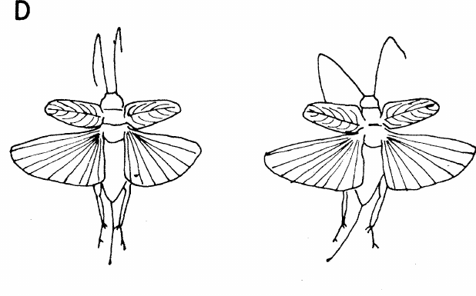
NEUR 411 · NEUROETHOLOGY · FALL 2026
Lecture 14
Insect hearing I:
cricket phonotaxis and song recognition (Hoy)
Friday, September 25, 2026
Jordan Lopez, Ph.D.
Professor of Neurobiology & Biomedical Engineering
Pollack & Hoy (1979), Fig. 2(D). Tethered field cricket during flight.
Notes:
Insect hearing I: cricket phonotaxis and song recognition (Hoy)
Lecture 14. NEUR 411 · NEUROETHOLOGY · FALL 2026. Friday, September 25, 2026.
Figure: Pollack & Hoy (1979), Fig. 2(D). Tethered field cricket during flight.
Figure source: https://doi.org/10.1126/science.204.4391.429
References:
Pollack GS, Hoy RR (1979). Temporal pattern as a cue for species-specific calling song recognition in crickets. Science 204(4391):429–432. https://doi.org/10.1126/science.204.4391.429

Slide 2
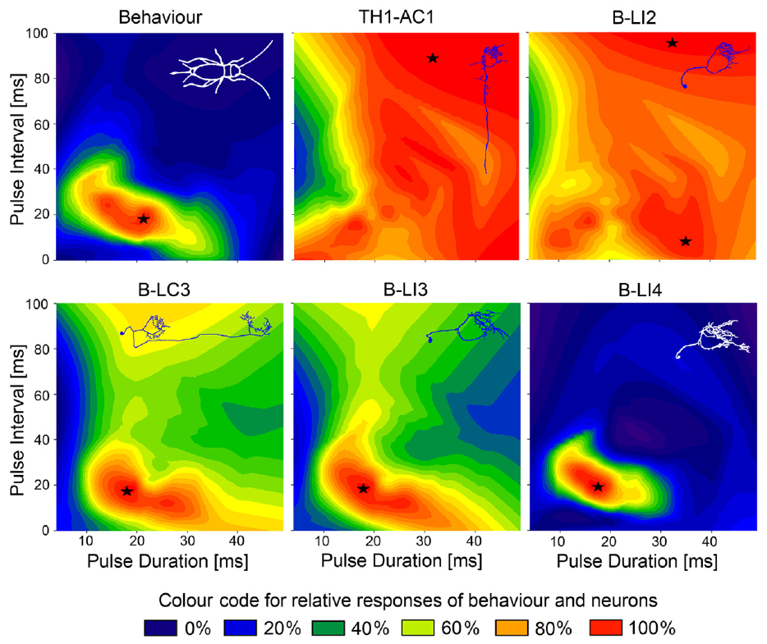
Females approach species-specific calling songs
Phonotaxis is movement oriented toward or away from a sound source. Female Gryllus bimaculatus approach the male calling song, a repeated sequence of brief sound pulses. A chirp groups several pulses before a longer silent interval.
Kostarakos and Hedwig tested tethered females walking on a trackball with synthetic songs whose carrier frequency was 4.8 kHz. The carrier frequency specifies the rapid sound oscillation within each pulse; pulse timing describes the slower pattern of its amplitude.
Females responded most strongly to pulse periods near 34–42 ms. Controlled synthetic patterns separate frequency from timing, supporting temporal selectivity rather than indiscriminate attraction to any audible sound. The heat maps preserve the distinction between pulse duration and the silent interval, so the preferred region in behavioral space can be compared with the response regions of neurons.
Kostarakos & Hedwig (2012), Fig. 6. Published behavior and neuronal response heat maps.
Kostarakos & Hedwig (2012)
02
Notes:
• **Phonotaxis** is movement oriented toward or away from a sound source. Female _Gryllus bimaculatus_ approach the male calling song, a repeated sequence of brief sound pulses. A **chirp** groups several pulses before a longer silent interval.
• Kostarakos and Hedwig tested tethered females walking on a trackball with synthetic songs whose carrier frequency was 4.8 kHz. The **carrier frequency** specifies the rapid sound oscillation within each pulse; pulse timing describes the slower pattern of its amplitude.
• Females responded most strongly to pulse periods near 34–42 ms. Controlled synthetic patterns separate frequency from timing, supporting temporal selectivity rather than indiscriminate attraction to any audible sound. The heat maps preserve the distinction between pulse duration and the silent interval, so the preferred region in behavioral space can be compared with the response regions of neurons.
• The heat maps preserve the authors’ distinction between pulse duration and the silent interval. A preferred region in behavioral space can be compared with neuronal response regions without assuming that any responding neuron recognizes the song.
References:
Kostarakos K, Hedwig B (2012). Calling song recognition in female crickets: temporal tuning of identified brain neurons matches behavior. Journal of Neuroscience 32(28):9601–9612. https://doi.org/10.1523/JNEUROSCI.1170-12.2012
Figure: Kostarakos & Hedwig (2012), Fig. 6. Published behavior and neuronal response heat maps.
Figure source: https://doi.org/10.1523/JNEUROSCI.1170-12.2012

Slide 3
Carrier frequency and pulse timing are separate
A cricket calling song has two kinds of structure. The carrier frequency is the rapid oscillation of sound pressure within each pulse, and the pulse timing is the slower pattern in which the amplitude rises and falls across pulses and the silent intervals between them.
A chirp groups several pulses before a longer silent interval, and the pulse period runs from the onset of one pulse to the onset of the next. Kostarakos and Hedwig held the carrier at 4.8 kHz and varied the pulse period, so the females were tested on timing alone.
Females responded most strongly to pulse periods near 34–42 ms. Because frequency and timing are controlled independently in synthetic songs, the response curve reflects a preference for a temporal pattern, and a female does not approach every audible sound.
Kostarakos & Hedwig (2012), Fig. 6. Published behavior and neuronal response heat maps.
Kostarakos & Hedwig (2012)
02a
Notes:
• Calling song carries information in its carrier frequency and in its pulse timing, and synthetic songs allow each to be varied alone.
• Two time scales.
– The carrier frequency specifies the rapid sound oscillation within each pulse.
– Pulse timing describes the slower pattern of amplitude across pulses and intervals.
• Song units.
– A chirp groups several pulses before a longer silent interval.
– The pulse period is measured from the onset of one pulse to the onset of the next.
• The test.
– Tethered females walked on a trackball while synthetic songs with a 4.8 kHz carrier were played from speakers.
– Steering on the trackball measured orientation toward the sound.
• What the preference curve means.
– The strongest responses occurred for pulse periods near 34–42 ms.
– The heat maps keep pulse duration and the silent interval separate, so a preferred region in behavioral space can be compared with the response regions of neurons.
• Heat maps of behavior and neurons.
– The published heat maps preserve the distinction between pulse duration and the silent interval.
– A preferred region in behavioral space can therefore be compared with neuronal response regions.
References:
Kostarakos K, Hedwig B (2012). Calling song recognition in female crickets: temporal tuning of identified brain neurons matches behavior. Journal of Neuroscience 32(28):9601–9612. https://doi.org/10.1523/JNEUROSCI.1170-12.2012

Slide 4
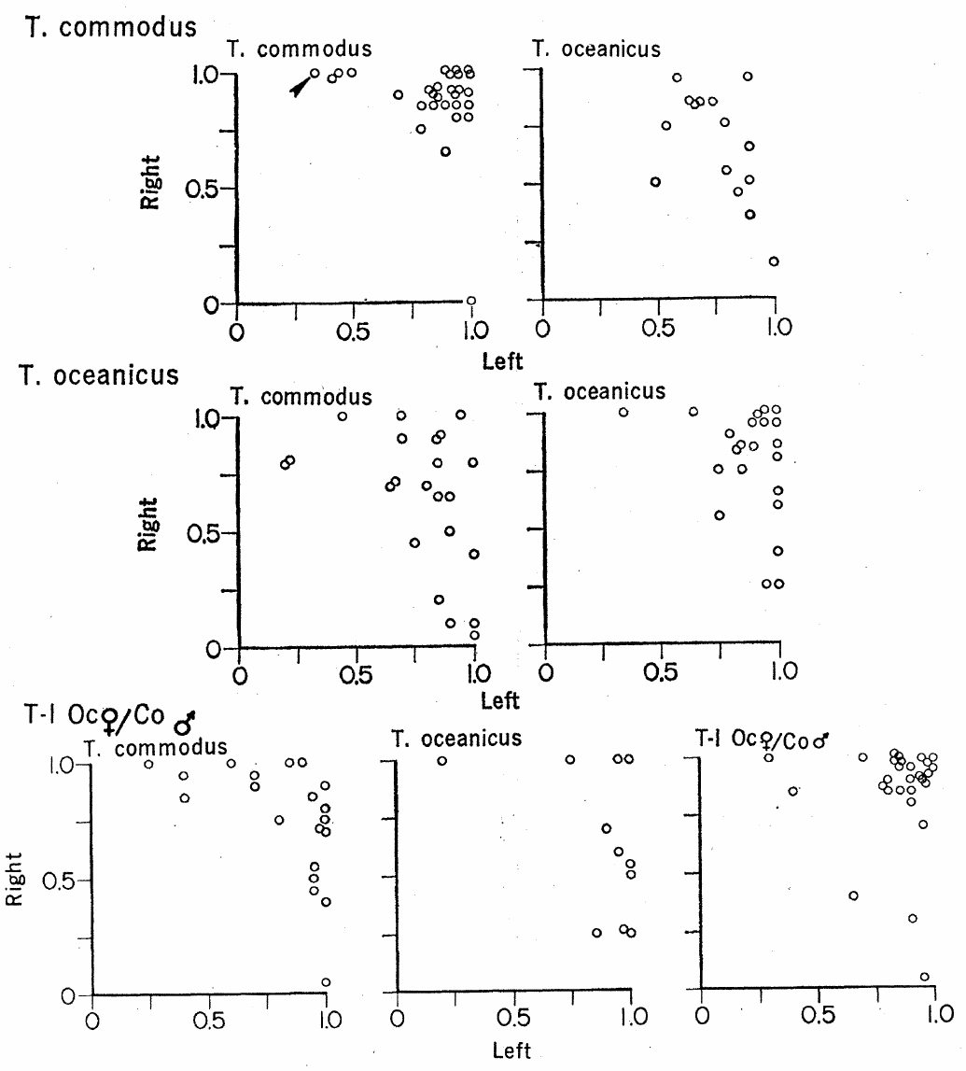
Hoy quantified directional song preference
Hoy and Paul studied Teleogryllus oceanicus and T. commodus, species with different calling-song rhythms. A phonomotor response was the female’s tendency to turn toward a song while walking on a small rotating Y-maze rather than traveling through an arena.
Speakers were positioned 94 cm from the maze and 40° to either side. Calls were presented at 69 dB, and the active speaker changed sides. Playback and recording temperatures were matched within 2°C because cricket song timing depends on temperature.
Females preferentially turned toward their own species’ song, although heterospecific songs could also attract them. Reversing speaker position distinguishes song preference from a persistent turning bias. A female's fixed position on the maze keeps the acoustic geometry constant while the supporting maze rotates beneath her, which separates repeated directional decisions from the changing distance and sound intensity of a free approach.
Hoy & Paul (1973), Fig. 1. Species and hybrid song preferences.
Hoy & Paul (1973)
03
Notes:
• Hoy and Paul studied _Teleogryllus oceanicus_ and _T. commodus_, species with different calling-song rhythms. A **phonomotor response** was the female’s tendency to turn toward a song while walking on a small rotating Y-maze rather than traveling through an arena.
• Speakers were positioned 94 cm from the maze and 40° to either side. Calls were presented at 69 dB, and the active speaker changed sides. Playback and recording temperatures were matched within 2°C because cricket song timing depends on temperature.
• Females preferentially turned toward their own species’ song, although heterospecific songs could also attract them. Reversing speaker position distinguishes song preference from a persistent turning bias. A female's fixed position on the maze keeps the acoustic geometry constant while the supporting maze rotates beneath her, which separates repeated directional decisions from the changing distance and sound intensity of a free approach.
• A female’s fixed position keeps the acoustic geometry constant while the supporting maze rotates beneath her. This separates repeated directional decisions from the changing distance and sound intensity experienced during free approach.
References:
Hoy RR, Paul RC (1973). Genetic control of song specificity in crickets. Science 180(4081):82–83. https://doi.org/10.1126/science.180.4081.82
Figure: Hoy & Paul (1973), Fig. 1. Species and hybrid song preferences.
Figure source: https://doi.org/10.1126/science.180.4081.82

Slide 5
Hybrid preference supports inherited signal matching
Hybrids are offspring produced by crossing the two cricket species. Hoy and Paul compared hybrid females’ responses to parental and hybrid calling songs. Hybrid male song contained rhythmic elements intermediate between the parental patterns rather than an unchanged copy of either parent’s song.
The same Y-maze assay and 69-dB playback allowed parental and hybrid responses to be compared under similar acoustic conditions. Hybrid females preferred hybrid calls over either parental call; strong preference required directional responding from both speaker positions.
The result supports inherited contributions to both signal production and reception. Hybrid males sing songs with rhythmic elements intermediate between the parental patterns, and hybrid females prefer the hybrid song, so the sender trait and the receiver trait changed together, which is the pattern expected from genetic coupling between signal and preference.
Hoy & Paul (1973), Fig. 1. Species and hybrid song preferences.
Hoy & Paul (1973)
04
Notes:
• **Hybrids** are offspring produced by crossing the two cricket species. Hoy and Paul compared hybrid females’ responses to parental and hybrid calling songs. Hybrid male song contained rhythmic elements intermediate between the parental patterns rather than an unchanged copy of either parent’s song.
• The same Y-maze assay and 69-dB playback allowed parental and hybrid responses to be compared under similar acoustic conditions. Hybrid females preferred hybrid calls over either parental call; strong preference required directional responding from both speaker positions.
• The result supports inherited contributions to both signal production and reception. Hybrid males sing songs with rhythmic elements intermediate between the parental patterns, and hybrid females prefer the hybrid song, so the sender trait and the receiver trait changed together, which is the pattern expected from genetic coupling between signal and preference.
• Genetic coupling is an interpretation of coordinated changes in sender and receiver traits. It is distinct from demonstrating a specific shared membrane protein or a synaptic connection between a singing circuit and a recognition circuit.
References:
Hoy RR, Paul RC (1973). Genetic control of song specificity in crickets. Science 180(4081):82–83. https://doi.org/10.1126/science.180.4081.82
Figure: Hoy & Paul (1973), Fig. 1. Species and hybrid song preferences.
Figure source: https://doi.org/10.1126/science.180.4081.82

Slide 6
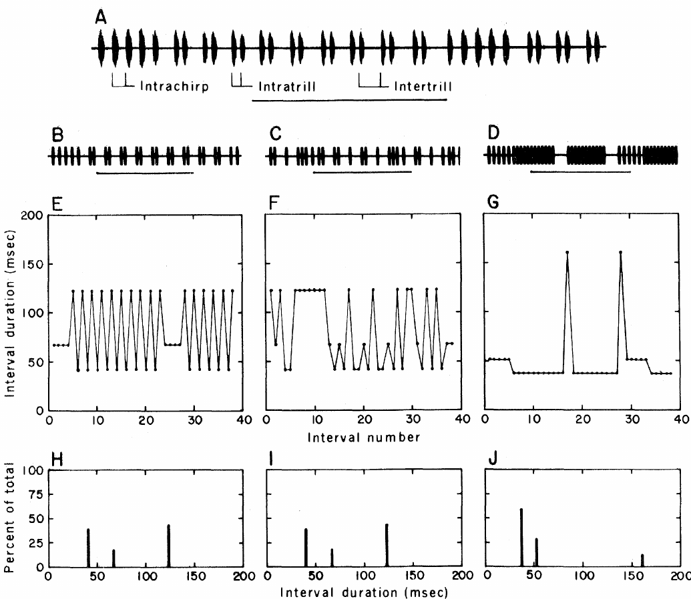
Temporal recognition can be isolated from frequency
Pollack and Hoy synthesized Teleogryllus songs electronically to isolate temporal structure. A pulse period runs from the onset of one pulse to the onset of the next, whereas a pulse interval ordinarily refers to the intervening silence in later cricket studies.
Their models of T. oceanicus and T. commodus song were presented with identical carrier frequencies of 4.5 or 5 kHz. Sound levels were matched within each assay: 65 dB for walking choices and 75 dB for flight steering.
Females preferred their conspecific temporal pattern in both preparations. Thus, frequency differences between the natural species’ songs were unnecessary for that discrimination. The two assays matched sound levels within each test and used identical carrier frequencies, so the preference reflects the temporal pattern of the song.
Pollack & Hoy (1979), Fig. 1(A–J). Normal, shuffled and heterospecific song intervals.
Pollack & Hoy (1979)
05
Notes:
• Pollack and Hoy synthesized _Teleogryllus_ songs electronically to isolate temporal structure. A **pulse period** runs from the onset of one pulse to the onset of the next, whereas a **pulse interval** ordinarily refers to the intervening silence in later cricket studies.
• Their models of _T. oceanicus_ and _T. commodus_ song were presented with identical carrier frequencies of 4.5 or 5 kHz. Sound levels were matched within each assay: 65 dB for walking choices and 75 dB for flight steering.
• Females preferred their conspecific temporal pattern in both preparations. Thus, frequency differences between the natural species’ songs were unnecessary for that discrimination. The two assays matched sound levels within each test and used identical carrier frequencies, so the preference reflects the temporal pattern of the song.
• The 1979 figure labels onset-to-onset measurements as interpulse intervals. Keeping that historical definition explicit prevents confusing its intervals with the silent intervals used in the 2015 paired-pulse experiments.
References:
Pollack GS, Hoy RR (1979). Temporal pattern as a cue for species-specific calling song recognition in crickets. Science 204(4391):429–432. https://doi.org/10.1126/science.204.4391.429
Figure: Pollack & Hoy (1979), Fig. 1(A–J). Normal, shuffled and heterospecific song intervals.
Figure source: https://doi.org/10.1126/science.204.4391.429

Slide 7
Pulse period and silent interval are different measures
A pulse period runs from the onset of one pulse to the onset of the next, so it includes both the sound and the silence that follows it. A pulse interval in later cricket studies ordinarily refers only to the silence between pulses, and the two measures differ by the pulse duration.
Pollack and Hoy labeled onset-to-onset measurements in their 1979 figure as interpulse intervals. That historical definition is distinct from the silent intervals used in the 2015 paired-pulse experiments, so values from the two papers cannot be compared without checking which definition each uses.
Pollack and Hoy presented electronically synthesized songs of Teleogryllus oceanicus and T. commodus with identical carrier frequencies of 4.5 or 5 kHz and matched sound levels. Females preferred their conspecific temporal pattern in both walking and flight, so the temporal pattern alone carried the species information.
Pollack & Hoy (1979), Fig. 1(A–J). Normal, shuffled and heterospecific song intervals.
Pollack & Hoy (1979)
05a
Notes:
• Timing terms in cricket studies have more than one definition, and the definition determines which numbers can be compared.
• Period and interval.
– A pulse period runs from the onset of one pulse to the onset of the next.
– A pulse interval ordinarily refers to the silence between pulses in later cricket studies.
• Why the 1979 labels matter.
– The 1979 figure labels onset-to-onset measurements as interpulse intervals.
– Keeping that definition explicit prevents confusing those intervals with the silent intervals used in the 2015 paired-pulse experiments.
• The synthetic songs.
– Models of T. oceanicus and T. commodus song carried identical frequencies of 4.5 or 5 kHz.
– Sound levels were matched within each assay, at 65 dB for walking choices and 75 dB for flight steering.
• The result.
– Females preferred their conspecific temporal pattern in both preparations, so differences in carrier frequency between the natural songs were unnecessary for the discrimination.
• Controls on the song.
– Identical carrier frequencies of 4.5 or 5 kHz and matched sound levels within each assay leave the temporal pattern as the difference between the two songs.
References:
Pollack GS, Hoy RR (1979). Temporal pattern as a cue for species-specific calling song recognition in crickets. Science 204(4391):429–432. https://doi.org/10.1126/science.204.4391.429

Slide 8
Shuffling preserves intervals but destroys sequence
A shuffled song retains the durations and relative numbers of the normal song’s onset-to-onset intervals while rearranging their order. Pollack and Hoy used a computer to shuffle the interval sequence repeatedly and synthesize the corresponding sound pulses.
The normal T. oceanicus song included intervals within chirps, within trills and between trills. Its ordered progression disappeared in the shuffled stimulus, but the interval-duration distribution remained. Normal and shuffled models were played at the same 4.5- or 5-kHz carrier.
Females did not consistently discriminate normal from shuffled song in either walking or flight. Recognition therefore need not require an exact ordered copy of the complete normal phrase. A histogram of interval durations can remain unchanged when the sequence of intervals changes markedly, so the shuffled control isolates the order of the intervals from the availability of the individual timing values.
Pollack & Hoy (1979), Fig. 1(A–J). Normal, shuffled and heterospecific song intervals.
Pollack & Hoy (1979)
06
Notes:
• A **shuffled song** retains the durations and relative numbers of the normal song’s onset-to-onset intervals while rearranging their order. Pollack and Hoy used a computer to shuffle the interval sequence repeatedly and synthesize the corresponding sound pulses.
• The normal _T. oceanicus_ song included intervals within chirps, within trills and between trills. Its ordered progression disappeared in the shuffled stimulus, but the interval-duration distribution remained. Normal and shuffled models were played at the same 4.5- or 5-kHz carrier.
• Females did not consistently discriminate normal from shuffled song in either walking or flight. Recognition therefore need not require an exact ordered copy of the complete normal phrase. A histogram of interval durations can remain unchanged when the sequence of intervals changes markedly, so the shuffled control isolates the order of the intervals from the availability of the individual timing values.
• A histogram of interval durations can remain unchanged when a sequential interval plot changes markedly. The control isolates order from the availability of individual timing values, rather than comparing a normal song with arbitrary noise.
References:
Pollack GS, Hoy RR (1979). Temporal pattern as a cue for species-specific calling song recognition in crickets. Science 204(4391):429–432. https://doi.org/10.1126/science.204.4391.429
Figure: Pollack & Hoy (1979), Fig. 1(A–J). Normal, shuffled and heterospecific song intervals.
Figure source: https://doi.org/10.1126/science.204.4391.429

Slide 9
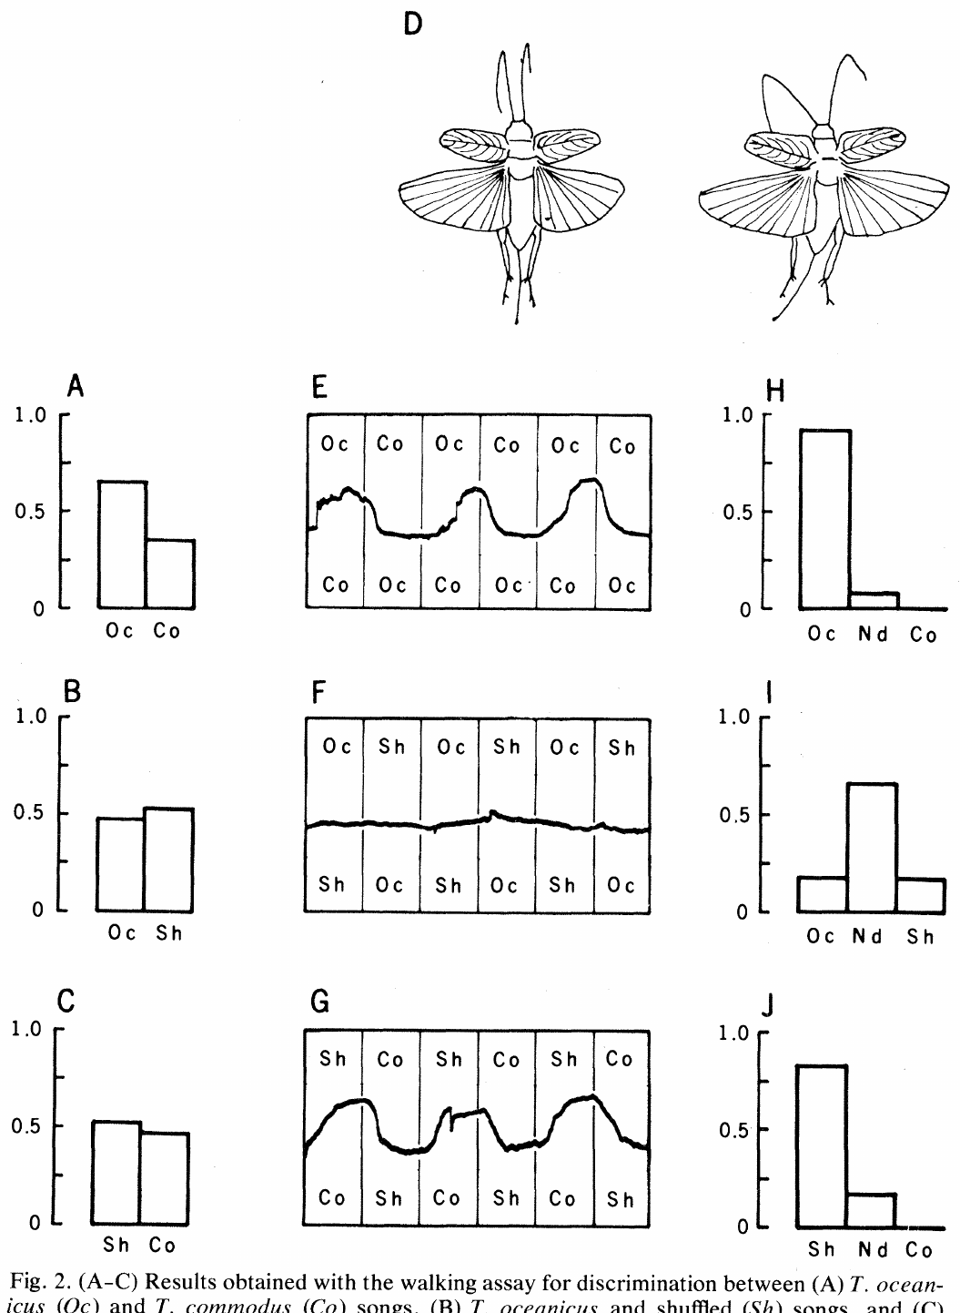
Assay context changes apparent song discrimination
Pollack and Hoy compared a two-speaker walking-choice assay with tethered flight in a wind stream. In flight, movements of the abdomen and hind legs provided a motor correlate of attempted turning, recorded optically while speaker assignments reversed every 30 s.
Normal T. oceanicus song was preferred to T. commodus song in both assays. Shuffled song was preferred to T. commodus song during flight, but the walking assay did not reveal the same discrimination, despite matched song frequencies within each test.
Different motor preparations can yield different expressions of acoustic preference. The authors suggested that flight might detect smaller differences in attractiveness. The walking and flight conditions also differ in stimulus level, 65 dB against 75 dB, and in behavioral state, so the assays provide convergent evidence for temporal recognition that is not interchangeable between motor outputs.
Pollack & Hoy (1979), Fig. 2(A–J). Walking choices and flight steering.
Pollack & Hoy (1979)
07
Notes:
• Pollack and Hoy compared a two-speaker walking-choice assay with tethered flight in a wind stream. In flight, movements of the abdomen and hind legs provided a motor correlate of attempted turning, recorded optically while speaker assignments reversed every 30 s.
• Normal _T. oceanicus_ song was preferred to _T. commodus_ song in both assays. Shuffled song was preferred to _T. commodus_ song during flight, but the walking assay did not reveal the same discrimination, despite matched song frequencies within each test.
• Different motor preparations can yield different expressions of acoustic preference. The authors suggested that flight might detect smaller differences in attractiveness. The walking and flight conditions also differ in stimulus level, 65 dB against 75 dB, and in behavioral state, so the assays provide convergent evidence for temporal recognition that is not interchangeable between motor outputs.
• The 65-dB walking and 75-dB flight conditions also differ in stimulus level and behavioral state. The assays provide convergent evidence for temporal recognition but are not interchangeable measures of an identical motor output.
References:
Pollack GS, Hoy RR (1979). Temporal pattern as a cue for species-specific calling song recognition in crickets. Science 204(4391):429–432. https://doi.org/10.1126/science.204.4391.429
Figure: Pollack & Hoy (1979), Fig. 2(A–J). Walking choices and flight steering.
Figure source: https://doi.org/10.1126/science.204.4391.429

Slide 10
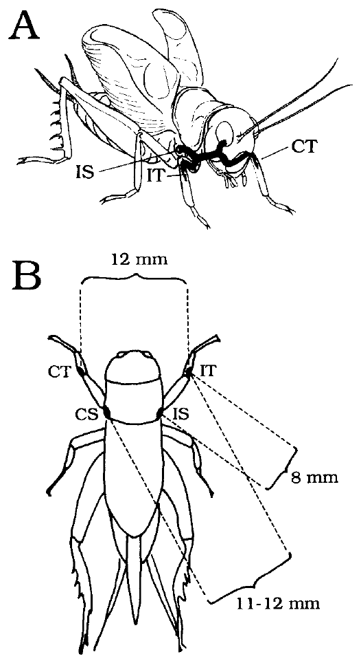
Foreleg ears receive sound through several routes
A cricket’s tympanum is a vibrating membrane in the foreleg tibia. A spiracle is an opening of the tracheal air system; the thoracic acoustic spiracles provide additional routes by which sound reaches the internal surface of each tympanum.
Michelsen and colleagues measured Gryllus bimaculatus ears with laser vibrometry and probe microphones. The original anatomical preparation identifies tympana and spiracles separated by distances of approximately 8–12 mm, far smaller than the wavelength of the calling-song sound.
The ear operates as a pressure-difference receiver: vibration depends on the difference between sound acting on its outer and inner surfaces. Connected air passages permit directional interference before auditory spikes are generated. Each tympanum has an external input plus internal contributions entering through both thoracic spiracles and the other ear, and directional vibration depends on the amplitude and phase with which those components combine.
Michelsen et al. (1994), Fig. 1(A–B). Foreleg ears and acoustic inputs.
Michelsen et al. (1994)
08
Notes:
• A cricket’s **tympanum** is a vibrating membrane in the foreleg tibia. A **spiracle** is an opening of the tracheal air system; the thoracic acoustic spiracles provide additional routes by which sound reaches the internal surface of each tympanum.
• Michelsen and colleagues measured _Gryllus bimaculatus_ ears with laser vibrometry and probe microphones. The original anatomical preparation identifies tympana and spiracles separated by distances of approximately 8–12 mm, far smaller than the wavelength of the calling-song sound.
• The ear operates as a **pressure-difference receiver**: vibration depends on the difference between sound acting on its outer and inner surfaces. Connected air passages permit directional interference before auditory spikes are generated. Their presence alone does not establish useful directionality; transmission amplitude and phase must also be measured.
• Ipsilateral means the same side as the ear under consideration, and contralateral means the opposite side. Each tympanum has an external input plus internal contributions entering through both thoracic spiracles and the other ear.
References:
Michelsen A, Popov AV, Lewis B (1994). Physics of directional hearing in the cricket Gryllus bimaculatus. Journal of Comparative Physiology A 175:153–164. https://doi.org/10.1007/BF00215111
Figure: Michelsen et al. (1994), Fig. 1(A–B). Foreleg ears and acoustic inputs.
Figure source: https://doi.org/10.1007/BF00215111

Slide 11
A pressure-difference receiver compares two surfaces
A cricket's tympanum is a vibrating membrane in the foreleg tibia, and sound can reach both of its surfaces. The outer surface receives sound from the air, and the inner surface receives sound through the tracheal air system and the thoracic acoustic spiracles.
The ear operates as a pressure-difference receiver, so its vibration depends on the difference between the sound acting on its outer and inner surfaces. Tympana and spiracles are separated by approximately 8–12 mm, far smaller than the wavelength of the calling song, so the external sound arrives at nearly the same time at each opening.
Connected air passages allow directional interference before auditory spikes are generated. Ipsilateral means the same side as the ear under consideration and contralateral means the opposite side, and each tympanum receives an external input plus internal contributions entering through both thoracic spiracles and the other ear.
Michelsen et al. (1994), Fig. 1(A–B). Foreleg ears and acoustic inputs.
Michelsen et al. (1994)
08a
Notes:
• A pressure-difference receiver responds to the difference between two sound pressures, and the tracheal system supplies the second pressure.
• Two surfaces of one membrane.
– The tympanum vibrates according to the difference between the sound acting on its outer surface and the sound acting on its inner surface.
– The inner surface is reached by internal air passages.
• Why small spacing matters.
– Tympana and spiracles are separated by approximately 8–12 mm, which is far smaller than the wavelength of the calling-song sound.
– The sound field therefore differs only slightly between the openings, and the internal route must convert that small difference into a directional response.
• Same side and opposite side.
– Ipsilateral means the same side as the ear under consideration, and contralateral means the opposite side.
– Each tympanum receives an external input plus internal contributions through both thoracic spiracles and the other ear.
• How the measurements were made.
– Michelsen and colleagues used laser vibrometry and probe microphones on Gryllus bimaculatus ears.
– Directional interference depends on the amplitude and the phase of each transmitted component.
References:
Michelsen A, Popov AV, Lewis B (1994). Physics of directional hearing in the cricket Gryllus bimaculatus. Journal of Comparative Physiology A 175:153–164. https://doi.org/10.1007/BF00215111

Slide 12
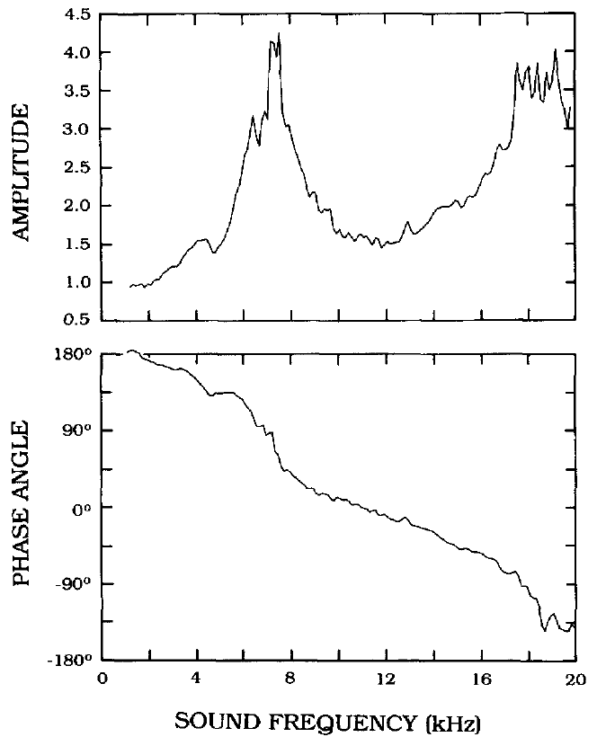
Tracheal transmission changes sound amplitude and phase
Transmission gain describes how strongly a sound component reaches the tympanum through an internal route. Phase describes its position within the sound’s oscillatory cycle. Two components can reinforce or oppose one another depending on both quantities.
Michelsen and colleagues applied local sound at one acoustic input while measuring tympanal vibration. Wax barriers reduced sound at other inputs by at least 20 dB. Ipsilateral-spiracle transmission gain peaked near 4–5 kHz, the calling-song frequency range.
The measured gain and phase specify how an internal sound component combines with the external input. Reinforcement depends on timing as well as amplitude, so a large internal component improves directionality only when its phase is favorable. The authors first measured the external tympanal transfer function and then used it to estimate the internal-route contribution, with a phase convention that accounts for sound pressure acting in opposite directions on the two surfaces of the membrane.
Michelsen et al. (1994), Fig. 5. Ipsilateral spiracle transmission gain and phase.
Michelsen et al. (1994), Fig. 1(A–B). Foreleg ears and acoustic inputs.
Michelsen et al. (1994)
09
Notes:
• **Transmission gain** describes how strongly a sound component reaches the tympanum through an internal route. **Phase** describes its position within the sound’s oscillatory cycle. Two components can reinforce or oppose one another depending on both quantities.
• Michelsen and colleagues applied local sound at one acoustic input while measuring tympanal vibration. Wax barriers reduced sound at other inputs by at least 20 dB. Ipsilateral-spiracle transmission gain peaked near 4–5 kHz, the calling-song frequency range.
• The measured gain and phase specify how an internal sound component combines with the external input. Reinforcement depends on timing as well as amplitude, so a large internal component improves directionality only when its phase is favorable. The authors first measured the external tympanal transfer function and then used it to estimate the internal-route contribution, with a phase convention that accounts for sound pressure acting in opposite directions on the two surfaces of the membrane.
• The authors first measured the external tympanal transfer function and then used it to estimate the internal-route contribution. Their phase convention accounts for sound pressure acting in opposite directions on the two surfaces of the membrane.
References:
Michelsen A, Popov AV, Lewis B (1994). Physics of directional hearing in the cricket Gryllus bimaculatus. Journal of Comparative Physiology A 175:153–164. https://doi.org/10.1007/BF00215111
Figure: Michelsen et al. (1994), Fig. 5. Ipsilateral spiracle transmission gain and phase.
Figure source: https://doi.org/10.1007/BF00215111
Figure: Michelsen et al. (1994), Fig. 1(A–B). Foreleg ears and acoustic inputs.
Figure source: https://doi.org/10.1007/BF00215111

Slide 13
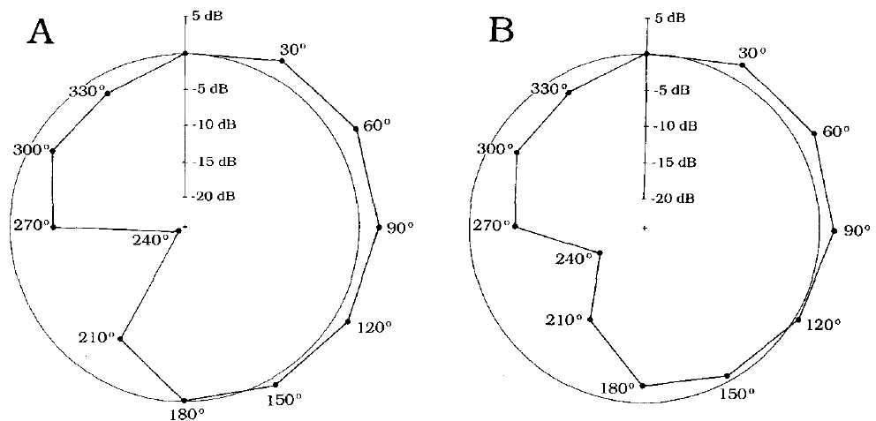
Opposite spiracle input sharpens directionality
For sound arriving from ahead, left and right external inputs differ only slightly because the cricket’s body is small. The contralateral acoustic spiracle supplies an internal component whose phase can convert that modest spatial difference into directional tympanal vibration.
Michelsen and colleagues calculated directional responses from measured input gains and phases. The opposite-spiracle component changed phase by approximately 130–140° as sound direction moved from 0° to 30° off the midline, strongly changing the predicted interference at the ear.
Including both spiracle routes produced forward directional tuning; omitting the contralateral contribution altered that pattern substantially. This supports a mechanical role for cross-body sound transmission. The contralateral tympanum made a smaller contribution than the contralateral spiracle in this preparation, so the measured transmission gains distinguish the importance of the different cross-body routes.
Michelsen et al. (1994), Fig. 11(A–B). Contralateral input changes directional tuning.
Michelsen et al. (1994), Fig. 1(A–B). Foreleg ears and acoustic inputs.
Michelsen et al. (1994)
10
Notes:
• For sound arriving from ahead, left and right external inputs differ only slightly because the cricket’s body is small. The contralateral acoustic spiracle supplies an internal component whose phase can convert that modest spatial difference into directional tympanal vibration.
• Michelsen and colleagues calculated directional responses from measured input gains and phases. The opposite-spiracle component changed phase by approximately 130–140° as sound direction moved from 0° to 30° off the midline, strongly changing the predicted interference at the ear.
• Including both spiracle routes produced forward directional tuning; omitting the contralateral contribution altered that pattern substantially. This supports a mechanical role for cross-body sound transmission. The contralateral tympanum made a smaller contribution than the contralateral spiracle in this preparation, so the measured transmission gains distinguish the importance of the different cross-body routes.
• The contralateral tympanum made a smaller contribution than the contralateral spiracle in this preparation. Treating all cross-body routes as equally important would lose the experimental distinction between their measured transmission gains.
References:
Michelsen A, Popov AV, Lewis B (1994). Physics of directional hearing in the cricket Gryllus bimaculatus. Journal of Comparative Physiology A 175:153–164. https://doi.org/10.1007/BF00215111
Figure: Michelsen et al. (1994), Fig. 11(A–B). Contralateral input changes directional tuning.
Figure source: https://doi.org/10.1007/BF00215111
Figure: Michelsen et al. (1994), Fig. 1(A–B). Foreleg ears and acoustic inputs.
Figure source: https://doi.org/10.1007/BF00215111

Slide 14
Phase decides whether sound components reinforce
Two components of sound can reinforce or oppose one another depending on both their amplitudes and their phases. Phase describes the position of a component within the oscillatory cycle, and transmission gain describes how strongly the component reaches the tympanum through an internal route.
For sound arriving from ahead, the left and right external inputs differ only slightly because the cricket's body is small. The contralateral acoustic spiracle supplies an internal component whose phase changed by approximately 130–140° as the sound direction moved from 0° to 30° off the midline.
A phase change of that size alters the interference at the ear strongly, so a modest spatial difference becomes a directional difference in vibration. Calculations that included both spiracle routes produced forward directional tuning, and omitting the contralateral contribution altered the pattern substantially.
Michelsen et al. (1994), Fig. 11(A–B). Contralateral input changes directional tuning.
Michelsen et al. (1994), Fig. 1(A–B). Foreleg ears and acoustic inputs.
Michelsen et al. (1994)
10a
Notes:
• Directional hearing in a small animal depends on phase, because the external sound barely differs between the two ears.
• Gain and phase.
– Transmission gain describes how strongly a sound component reaches the tympanum, and phase describes its position within the oscillatory cycle.
– Two components can reinforce or oppose each other depending on both quantities.
• The small-body problem.
– For sound from ahead, the left and right external inputs differ only slightly.
– The contralateral spiracle contributes an internal component whose phase can convert that modest difference into directional vibration.
• The measured phase shift.
– The opposite-spiracle component changed phase by approximately 130–140° between 0° and 30° off the midline.
– The calculation combined measured gains and phases for each input.
• Relative contributions.
– The contralateral tympanum made a smaller contribution than the contralateral spiracle in this preparation, so the two cross-body routes differ in importance.
• Reading the result.
– Including both spiracle routes in the calculation produced forward directional tuning, and omitting the contralateral contribution altered that pattern substantially.
– The result supports a mechanical role for cross-body sound transmission in directional hearing.
References:
Michelsen A, Popov AV, Lewis B (1994). Physics of directional hearing in the cricket Gryllus bimaculatus. Journal of Comparative Physiology A 175:153–164. https://doi.org/10.1007/BF00215111

Slide 15
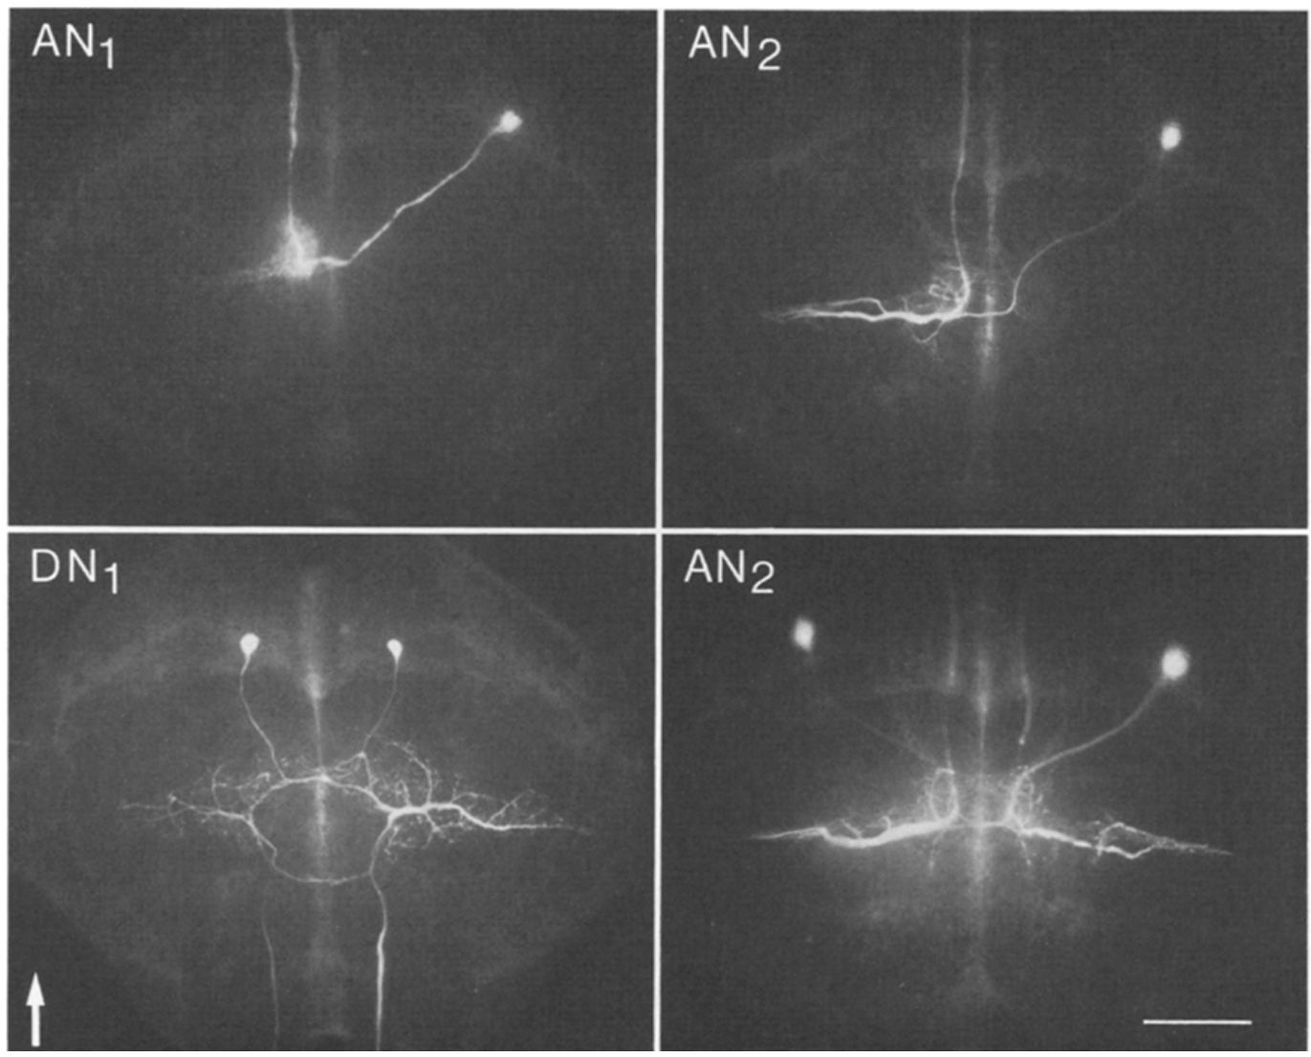
Thoracic auditory cells occupy distinct anatomical routes
The prothoracic ganglion is the segmental neural center associated with the first thoracic segment and forelegs. Auditory sensory axons terminate in its auditory neuropil, a region containing interacting neuronal branches rather than a collection of cell bodies alone.
Wohlers and Huber recorded individual neurons in female Gryllus campestris and filled them with Lucifer dye. Stimuli covered 2–20 kHz, and filled processes were examined after recording to connect a cell’s acoustic responses with its anatomical projection.
Ascending neurons carried signals toward the head, whereas local omega neurons remained within the thoracic ganglion. The fluorescent micrographs establish identified routes for early auditory processing. Anatomical identity allows responses from repeated preparations to be attributed to a named cell type instead of being grouped only by their firing pattern.
Wohlers & Huber (1982), Fig. 1. Dye-labeled auditory interneurons.
Wohlers & Huber (1982)
11
Notes:
• The **prothoracic ganglion** is the segmental neural center associated with the first thoracic segment and forelegs. Auditory sensory axons terminate in its auditory **neuropil**, a region containing interacting neuronal branches rather than a collection of cell bodies alone.
• Wohlers and Huber recorded individual neurons in female _Gryllus campestris_ and filled them with Lucifer dye. Stimuli covered 2–20 kHz, and filled processes were examined after recording to connect a cell’s acoustic responses with its anatomical projection.
• Ascending neurons carried signals toward the head, whereas local omega neurons remained within the thoracic ganglion. The fluorescent micrographs establish identified routes for early auditory processing. Anatomical identity allows responses from repeated preparations to be attributed to a named cell type instead of being grouped only by their firing pattern.
• The source reports a 200-μm calibration for the labeled material. Anatomical identity allows responses from repeated preparations to be attributed to a named cell type rather than grouped only by their firing pattern.
References:
Wohlers DW, Huber F (1982). Processing of sound signals by six types of neurons in the prothoracic ganglion of the cricket, Gryllus campestris L. Journal of Comparative Physiology A 146:161–173. https://doi.org/10.1007/BF00610234
Figure: Wohlers & Huber (1982), Fig. 1. Dye-labeled auditory interneurons.
Figure source: https://doi.org/10.1007/BF00610234

Slide 16
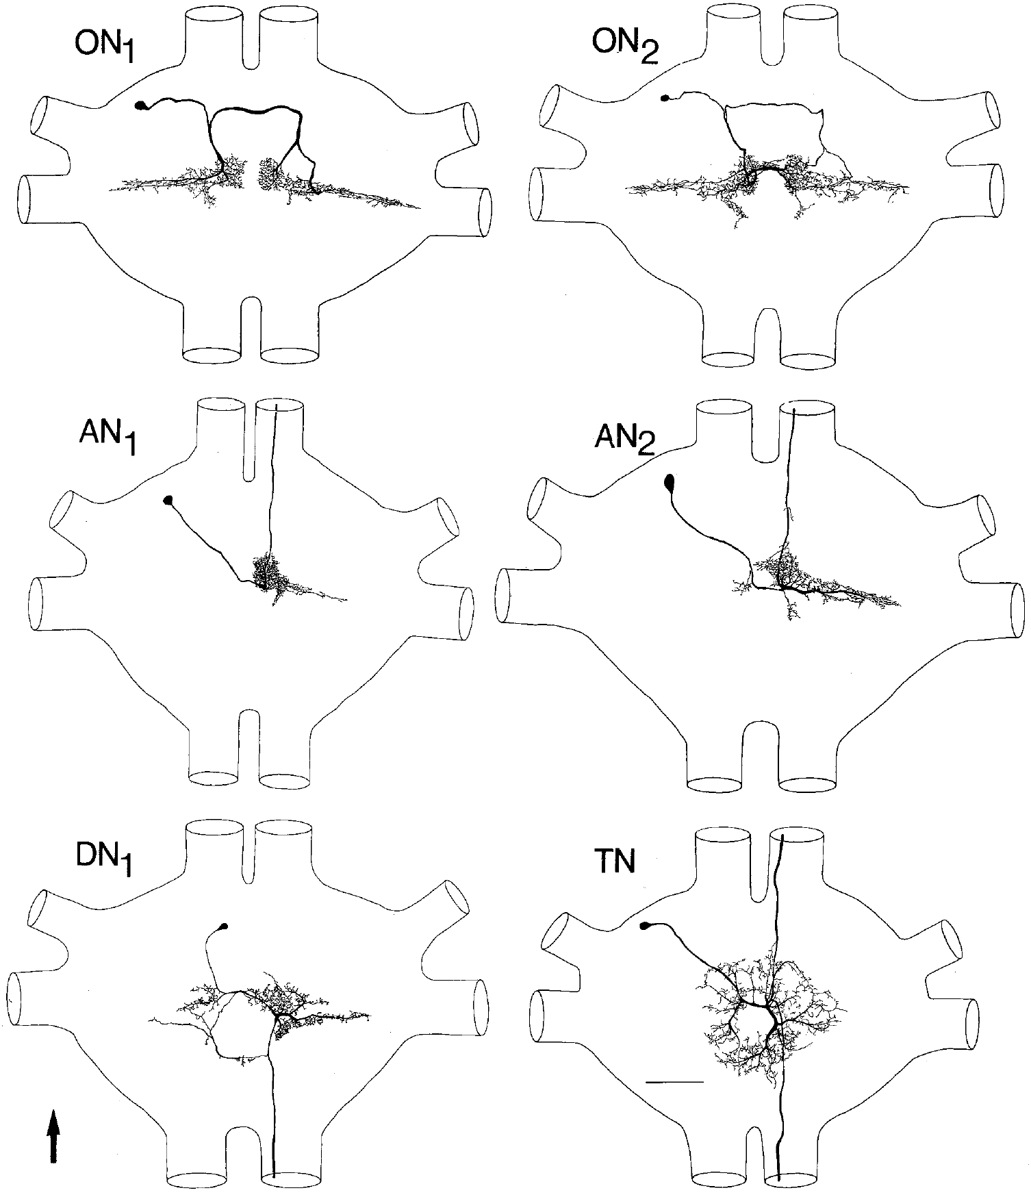
Six cell types distribute early auditory information
Wohlers and Huber identified six types of auditory interneuron arranged as bilateral mirror-image pairs. An interneuron receives and processes neuronal inputs rather than directly serving as a sensory receptor or the final motor neuron supplying a muscle.
ON1 and ON2 had omega-shaped local branches; AN1 and AN2 projected upward toward the brain; DN1 projected downward; and TN had both ascending and descending branches. Their responses were characterized with synthetic chirps and 2–20-kHz stimulation under separate-ear conditions.
These routes permit local comparisons and transmission of acoustic information to different neural centers. The names describe identified anatomical classes, the side of a cell body is distinct from the side supplying its excitation, and the reconstructions share a common scale so that branching patterns can be compared directly.
Wohlers & Huber (1982), Fig. 2. Six identified neuron types.
Wohlers & Huber (1982)
12
Notes:
• Wohlers and Huber identified six types of auditory interneuron arranged as bilateral mirror-image pairs. An **interneuron** receives and processes neuronal inputs rather than directly serving as a sensory receptor or the final motor neuron supplying a muscle.
• ON1 and ON2 had omega-shaped local branches; AN1 and AN2 projected upward toward the brain; DN1 projected downward; and TN had both ascending and descending branches. Their responses were characterized with synthetic chirps and 2–20-kHz stimulation under separate-ear conditions.
• These routes permit local comparisons and transmission of acoustic information to different neural centers. The names describe identified anatomical classes, the side of a cell body is distinct from the side supplying its excitation, and the reconstructions share a common scale so that branching patterns can be compared directly.
• Names describe identified anatomical classes, and the side of a cell body must be distinguished from the side supplying excitation. The reconstructions preserve the original common scale so their branching patterns can be compared directly.
References:
Wohlers DW, Huber F (1982). Processing of sound signals by six types of neurons in the prothoracic ganglion of the cricket, Gryllus campestris L. Journal of Comparative Physiology A 146:161–173. https://doi.org/10.1007/BF00610234
Figure: Wohlers & Huber (1982), Fig. 2. Six identified neuron types.
Figure source: https://doi.org/10.1007/BF00610234

Slide 17
Thoracic interneurons form local and ascending routes
An interneuron receives and processes neuronal inputs and is neither a sensory receptor nor the final motor neuron that supplies a muscle. In the prothoracic ganglion, auditory sensory axons end in the auditory neuropil, a region of interacting neuronal branches.
Wohlers and Huber recorded individual neurons in female Gryllus campestris and filled each with Lucifer dye, which allowed a cell's acoustic responses to be connected with its anatomical projection. They identified six types arranged as bilateral mirror-image pairs.
ON1 and ON2 have omega-shaped local branches, AN1 and AN2 project upward toward the brain, DN1 projects downward, and TN has both ascending and descending branches. Local cells permit comparisons within the thoracic ganglion, and ascending cells carry acoustic information to different neural centers.
Wohlers & Huber (1982), Fig. 2. Six identified neuron types.
Wohlers & Huber (1982)
12a
Notes:
• Naming the cell types gives the auditory pathway a map, with local cells that stay in the thoracic ganglion and ascending cells that reach the brain.
• What an interneuron is.
– An interneuron receives and processes neuronal inputs rather than serving as a sensory receptor or as the final motor neuron.
– The auditory neuropil is the part of the prothoracic ganglion where sensory axons terminate and branches interact.
• How the cells were identified.
– Each recorded neuron was filled with Lucifer dye, so its acoustic response could be matched to its anatomy.
– Anatomical identity allows responses from repeated preparations to be attributed to a named cell type.
• The six types.
– ON1 and ON2 have local omega-shaped branches, AN1 and AN2 ascend toward the brain, DN1 descends, and TN branches in both directions.
– The cells come in mirror-image pairs on the two sides of the ganglion.
• Scale and comparison.
– The reconstructions share a common scale so that their branching patterns can be compared directly.
References:
Wohlers DW, Huber F (1982). Processing of sound signals by six types of neurons in the prothoracic ganglion of the cricket, Gryllus campestris L. Journal of Comparative Physiology A 146:161–173. https://doi.org/10.1007/BF00610234

Slide 18
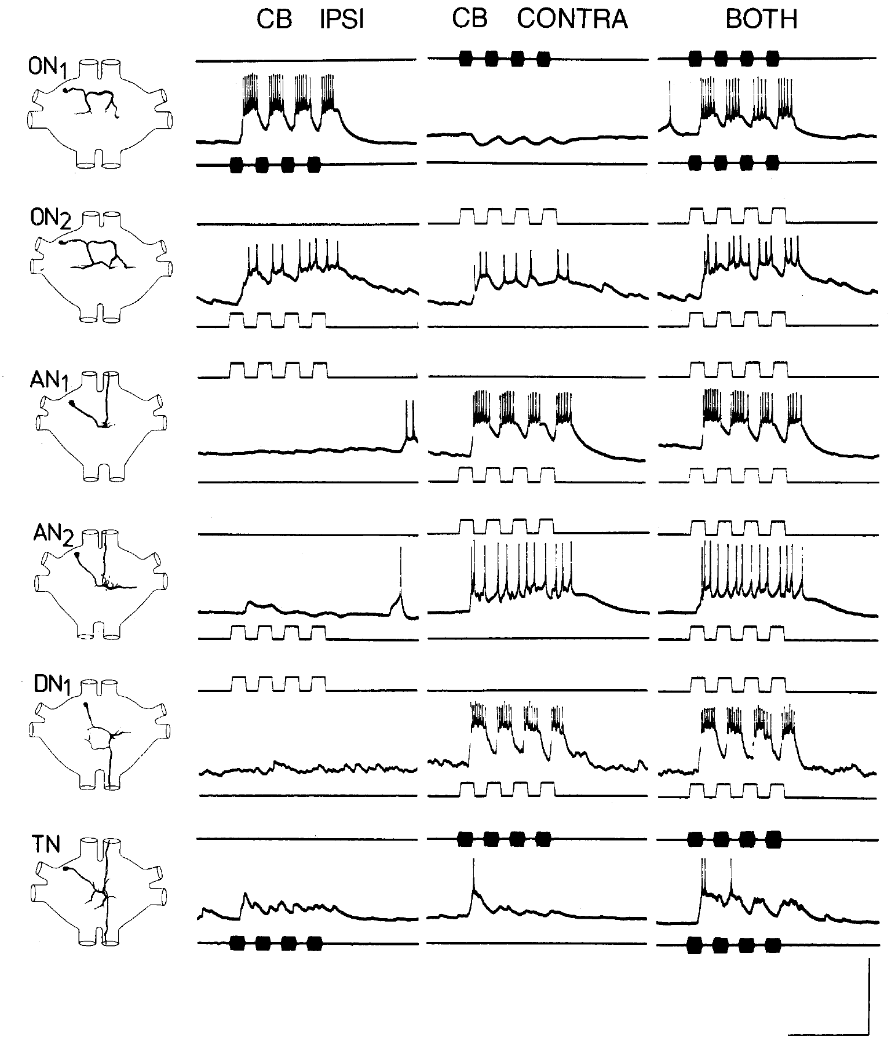
ON1 combines excitation with opposite inhibition
Excitation increases a neuron’s tendency to fire, whereas inhibition reduces that tendency through synaptic effects on its membrane potential or conductance. In ON1, the ear on the cell-body side supplies excitation and the opposite ear supplies inhibition.
Wohlers and Huber separated the ears acoustically with legphones, cut the connecting trachea and sealed thoracic spiracles. Four-pulse calling-song stimuli at 4.5 kHz were presented to each ear alone and then together while recording intracellularly from identified cells.
ON1’s response to bilateral stimulation reflects interacting neural inputs rather than acoustic cross-talk alone. This configuration supports an early neural comparison between sides. Monaural stimulation activates one ear and binaural stimulation activates both, and the isolated-ear controls remove much of the peripheral acoustic interaction so that differences in membrane response can be attributed more securely to central processing.
Wohlers & Huber (1982), Fig. 6. Separate-ear and bilateral stimulation.
Wohlers & Huber (1982)
13
Notes:
• **Excitation** increases a neuron’s tendency to fire, whereas **inhibition** reduces that tendency through synaptic effects on its membrane potential or conductance. In ON1, the ear on the cell-body side supplies excitation and the opposite ear supplies inhibition.
• Wohlers and Huber separated the ears acoustically with legphones, cut the connecting trachea and sealed thoracic spiracles. Four-pulse calling-song stimuli at 4.5 kHz were presented to each ear alone and then together while recording intracellularly from identified cells.
• ON1’s response to bilateral stimulation reflects interacting neural inputs rather than acoustic cross-talk alone. This configuration supports an early neural comparison between sides. Monaural stimulation activates one ear and binaural stimulation activates both, and the isolated-ear controls remove much of the peripheral acoustic interaction so that differences in membrane response can be attributed more securely to central processing.
• Monaural stimulation activates one ear, whereas binaural stimulation activates both. The isolated-ear controls remove much of the peripheral acoustic interaction so that differences in membrane response can be attributed more securely to central processing.
References:
Wohlers DW, Huber F (1982). Processing of sound signals by six types of neurons in the prothoracic ganglion of the cricket, Gryllus campestris L. Journal of Comparative Physiology A 146:161–173. https://doi.org/10.1007/BF00610234
Figure: Wohlers & Huber (1982), Fig. 6. Separate-ear and bilateral stimulation.
Figure source: https://doi.org/10.1007/BF00610234

Slide 19
Opposite-ear inhibition creates an early comparison
Excitation increases a neuron's tendency to fire, whereas inhibition reduces that tendency through synaptic effects on its membrane potential or conductance. In ON1, the ear on the same side as the cell body supplies excitation and the opposite ear supplies inhibition.
A neuron that is excited by one ear and inhibited by the other responds according to the balance between them, so its output compares the sound at the two ears before the signal leaves the thoracic ganglion. Binaural stimulation therefore produces a response that reflects the difference between sides.
Wohlers and Huber isolated the ears acoustically with legphones, cut the connecting trachea and sealed the thoracic spiracles. Four-pulse calling-song stimuli at 4.5 kHz were presented to each ear alone and then together, which attributes differences in the membrane response to central processing.
Wohlers & Huber (1982), Fig. 6. Separate-ear and bilateral stimulation.
Wohlers & Huber (1982)
13a
Notes:
• A neuron with excitation from one ear and inhibition from the other computes a difference, and that difference carries information about sound direction.
• Excitation and inhibition.
– Excitation increases the tendency to fire.
– Inhibition reduces that tendency by changing the membrane potential or conductance.
• Why a balance matters.
– In ON1, the same-side ear excites and the opposite ear inhibits, so the response depends on which side is louder.
– This is an early neural comparison between the two ears.
• Controls that isolate the neural interaction.
– Legphones delivered sound to one ear at a time, the trachea connecting the ears was cut and the spiracles were sealed.
– Monaural stimulation activates one ear and binaural stimulation activates both, so the differences in membrane response reflect central processing.
• The stimulus.
– Four-pulse calling-song patterns at 4.5 kHz were presented to each ear alone and then together while recording intracellularly from identified cells.
• Where the comparison occurs.
– ON1 is a local omega cell, so the comparison between the two ears happens in the thoracic ganglion before the signal ascends to the brain.
References:
Wohlers DW, Huber F (1982). Processing of sound signals by six types of neurons in the prothoracic ganglion of the cricket, Gryllus campestris L. Journal of Comparative Physiology A 146:161–173. https://doi.org/10.1007/BF00610234

Slide 20
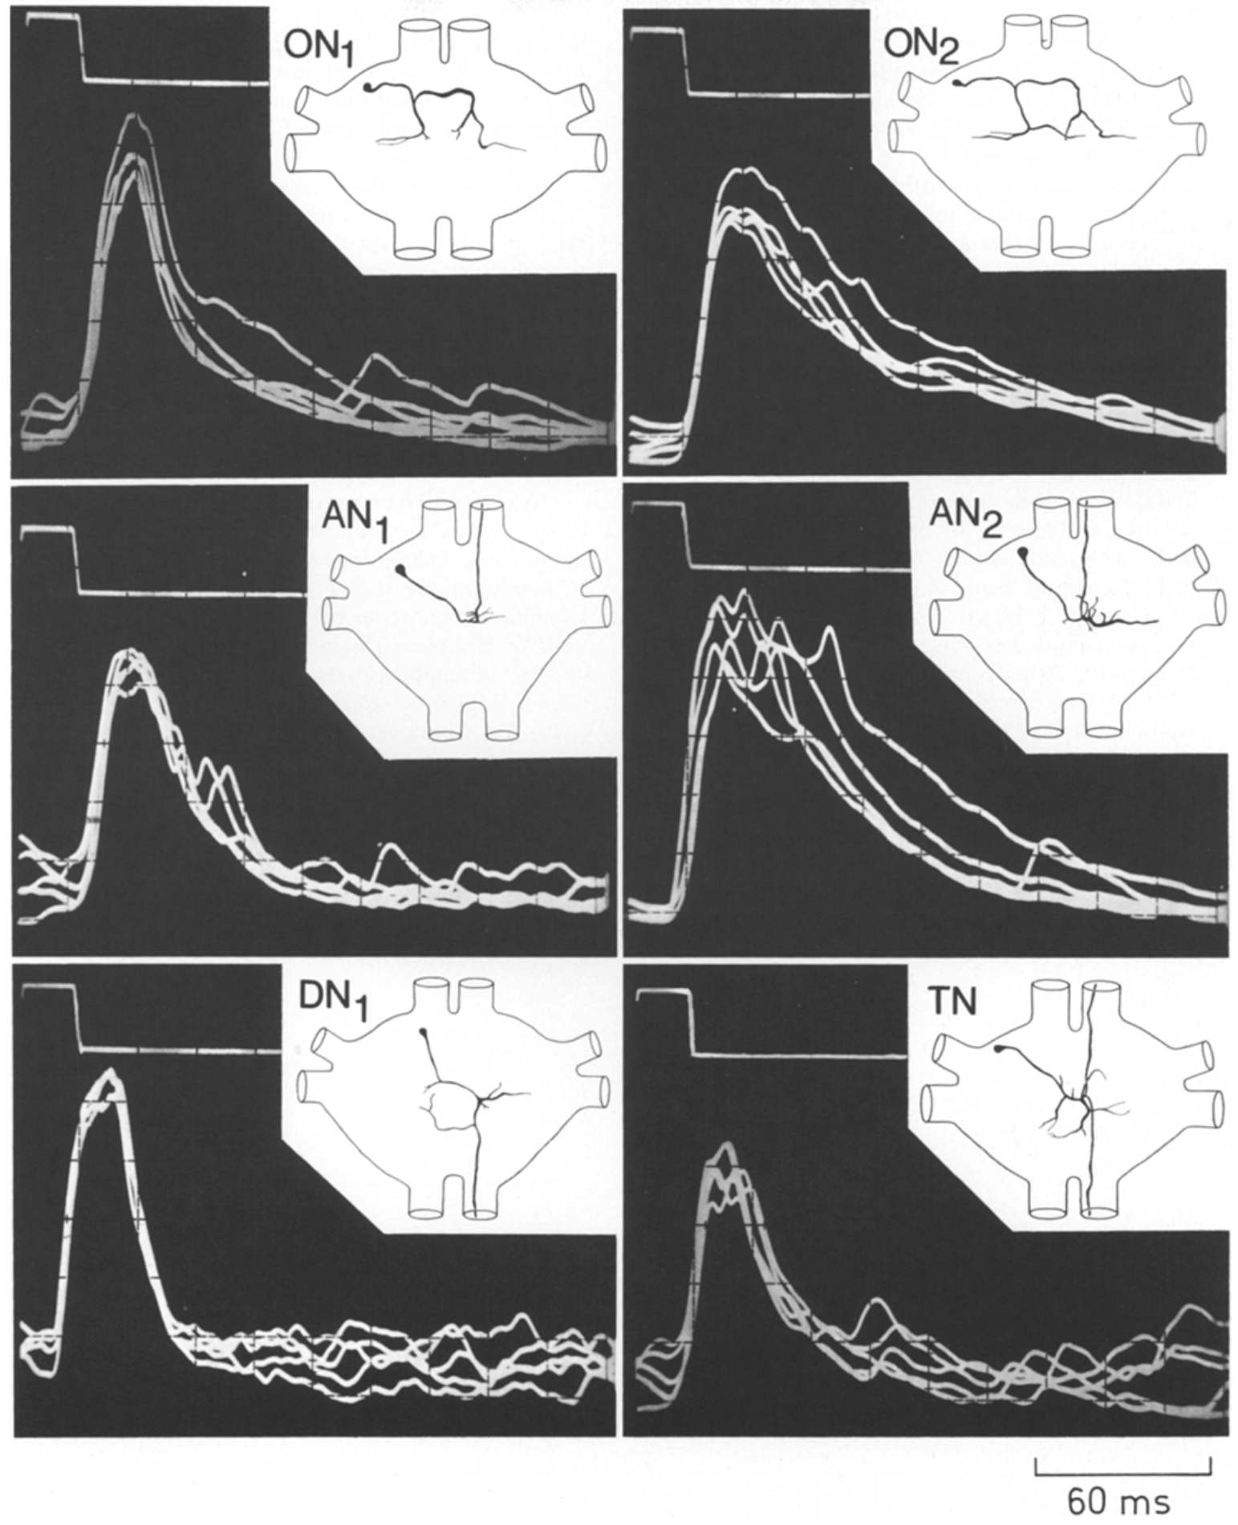
AN1 copies pulses without recognizing the pattern
AN1, the first ascending auditory neuron, carries calling-song information from thoracic neuropil toward the brain. Its excitatory response is driven predominantly by the ear opposite its cell body, a laterality convention that differs from the excitatory side of ON1.
Wohlers and Huber recorded responses to 1-syllable chirps across sound frequencies. A 20-ms pulse near 4.5 kHz produced excitation, and AN1 followed the pulse-and-pause structure of calling-song patterns more accurately than several other thoracic neurons.
Accurate copying makes AN1 a useful input to later temporal processing, but copying is distinct from selectivity. The thoracic cell continued responding to patterns outside the behaviorally preferred interval range. Its spikes report the sound events that are available, and multiple excitatory postsynaptic potentials can sum until the spike threshold is crossed, so the voltage recordings distinguish synaptic integration from the final spike train.
Wohlers & Huber (1982), Fig. 4. Intracellular responses and neuron shapes.
Wohlers & Huber (1982)
14
Notes:
• **AN1**, the first ascending auditory neuron, carries calling-song information from thoracic neuropil toward the brain. Its excitatory response is driven predominantly by the ear opposite its cell body, a laterality convention that differs from the excitatory side of ON1.
• Wohlers and Huber recorded responses to 1-syllable chirps across sound frequencies. A 20-ms pulse near 4.5 kHz produced excitation, and AN1 followed the pulse-and-pause structure of calling-song patterns more accurately than several other thoracic neurons.
• Accurate copying makes AN1 a useful input to later temporal processing, but copying is distinct from selectivity. The thoracic cell continued responding to patterns outside the behaviorally preferred interval range. Its spikes report the sound events that are available, and multiple excitatory postsynaptic potentials can sum until the spike threshold is crossed, so the voltage recordings distinguish synaptic integration from the final spike train.
• An excitatory postsynaptic potential, or EPSP, is a membrane depolarization produced by synaptic input. Multiple EPSPs can sum until the spike threshold is crossed; the voltage recordings and neuronal reconstructions distinguish that integration from the final spike train.
References:
Wohlers DW, Huber F (1982). Processing of sound signals by six types of neurons in the prothoracic ganglion of the cricket, Gryllus campestris L. Journal of Comparative Physiology A 146:161–173. https://doi.org/10.1007/BF00610234
Figure: Wohlers & Huber (1982), Fig. 4. Intracellular responses and neuron shapes.
Figure source: https://doi.org/10.1007/BF00610234

Slide 21
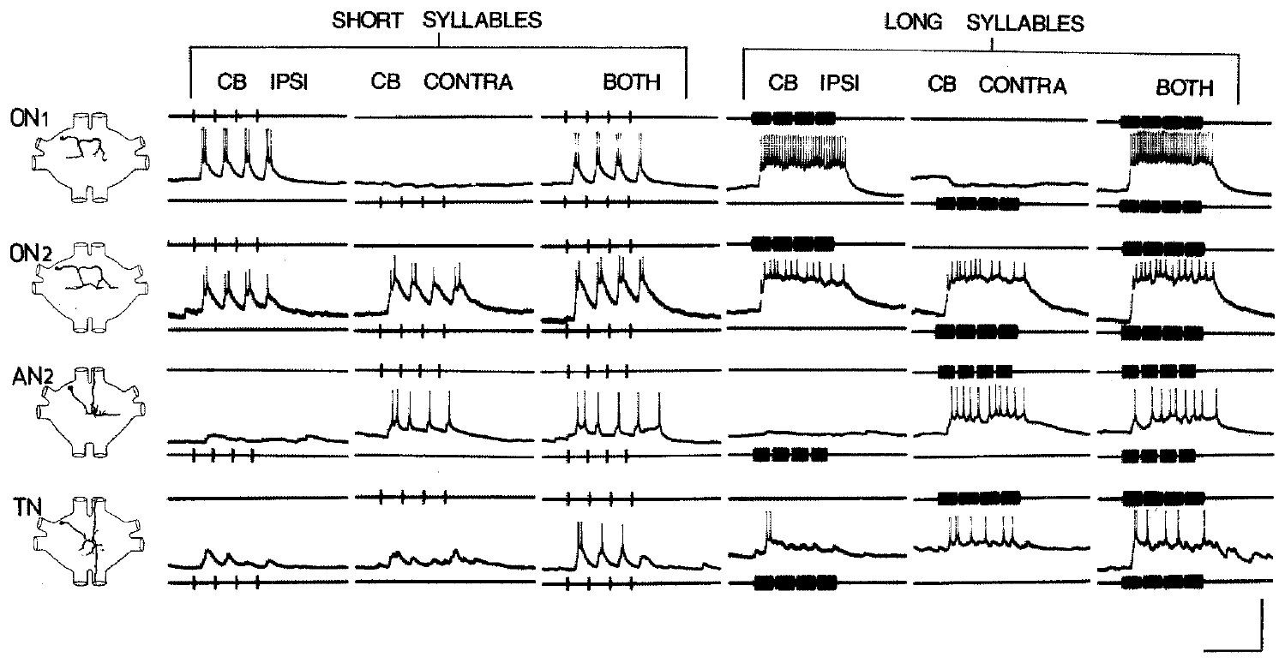
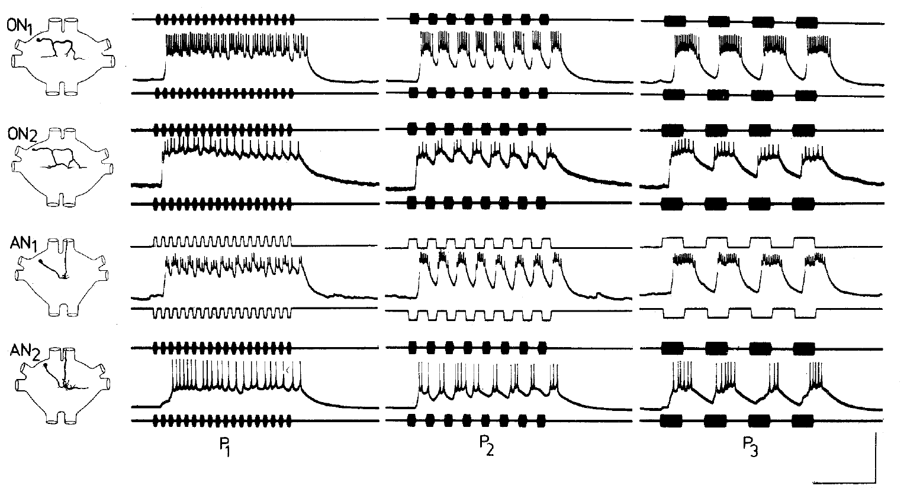
Thoracic resolution exceeds recognition selectivity
Temporal resolution is the ability of a response to preserve separate sound events. It differs from temporal preference, which requires a stronger response to particular timing values. A neuron may resolve many pulse patterns without favoring the species-specific pattern.
Wohlers and Huber tested 2.5-ms syllables and progressively shorter pauses. The six thoracic neuron types could copy those brief pulses, but none reliably copied pauses shorter than 5 ms. Equal-duration syllable and pause patterns were also tested over different repetition periods.
Behavior was preferentially elicited by approximately 20–60-ms silent intervals in the compared conditions, yet the recorded thoracic cells were not specifically tuned to that entire range. The difference places a recognition problem downstream of simple event copying. Species, stimulus definitions and duty cycle differ across these experiments, so the thoracic stimuli, the cited behavioral comparison and the pulse-period optimum measured in Gryllus bimaculatus in 2012 are separate measurements.
Wohlers & Huber (1982), Fig. 8. Responses to short and long syllables.
Wohlers & Huber (1982), Fig. 9. Responses to varied syllable periods.
Wohlers & Huber (1982)
15
Notes:
• **Temporal resolution** is the ability of a response to preserve separate sound events. It differs from temporal preference, which requires a stronger response to particular timing values. A neuron may resolve many pulse patterns without favoring the species-specific pattern.
• Wohlers and Huber tested 2.5-ms syllables and progressively shorter pauses. The six thoracic neuron types could copy those brief pulses, but none reliably copied pauses shorter than 5 ms. Equal-duration syllable and pause patterns were also tested over different repetition periods.
• Behavior was preferentially elicited by approximately 20–60-ms silent intervals in the compared conditions, yet the recorded thoracic cells were not specifically tuned to that entire range. The difference places a recognition problem downstream of simple event copying. Species, stimulus definitions and duty cycle differ across these experiments, so the thoracic stimuli, the cited behavioral comparison and the pulse-period optimum measured in Gryllus bimaculatus in 2012 are separate measurements.
• The original neuronal stimuli and the cited behavioral comparison must not be confused with the pulse-period optimum measured in Gryllus bimaculatus in 2012. Species, stimulus definitions and duty cycle differ across these experiments.
References:
Wohlers DW, Huber F (1982). Processing of sound signals by six types of neurons in the prothoracic ganglion of the cricket, Gryllus campestris L. Journal of Comparative Physiology A 146:161–173. https://doi.org/10.1007/BF00610234
Figure: Wohlers & Huber (1982), Fig. 8. Responses to short and long syllables.
Figure source: https://doi.org/10.1007/BF00610234
Figure: Wohlers & Huber (1982), Fig. 9. Responses to varied syllable periods.
Figure source: https://doi.org/10.1007/BF00610234

Slide 22
Temporal resolution differs from temporal preference
Temporal resolution is the ability of a response to preserve separate sound events. Temporal preference is a stronger response to particular timing values, so a neuron can resolve many pulse patterns without favoring the species-specific pattern.
Wohlers and Huber tested syllables of 2.5 ms and progressively shorter pauses. All six thoracic neuron types could copy the brief pulses, but none reliably copied pauses shorter than 5 ms, and the cells followed patterns across a wide range of repetition periods.
Behavior was elicited preferentially by silent intervals of approximately 20–60 ms, yet the recorded thoracic cells were not tuned to that entire range. A neuron that copies pulses faithfully supplies the information that a later stage needs, and the selective response to the species rhythm arises downstream.
Wohlers & Huber (1982), Fig. 8. Responses to short and long syllables.
Wohlers & Huber (1982), Fig. 9. Responses to varied syllable periods.
Wohlers & Huber (1982)
15a
Notes:
• Resolution describes how well a neuron keeps pulses separate, and preference describes which timing the neuron favors, so the two properties can differ in one cell.
• Definitions.
– Temporal resolution is the ability of a response to preserve separate sound events.
– Temporal preference requires a stronger response to particular timing values.
• The thoracic result.
– The six thoracic neuron types copied 2.5 ms pulses, and none reliably copied pauses shorter than 5 ms.
– Equal-duration syllable and pause patterns were also tested over different repetition periods.
• The mismatch with behavior.
– Behavior was elicited preferentially by silent intervals of approximately 20–60 ms, whereas the thoracic cells were not tuned to that range.
– The difference places a recognition problem downstream of simple event copying.
• Separate experiments.
– Species, stimulus definitions and duty cycle differ between this study and the pulse-period optimum measured in Gryllus bimaculatus in 2012.
• Why copying matters for the pathway.
– Faithful pulse copying by thoracic cells supplies the timing information, and selective responses to the song rhythm appear in the brain neurons recorded in Gryllus bimaculatus.
References:
Wohlers DW, Huber F (1982). Processing of sound signals by six types of neurons in the prothoracic ganglion of the cricket, Gryllus campestris L. Journal of Comparative Physiology A 146:161–173. https://doi.org/10.1007/BF00610234

Slide 23
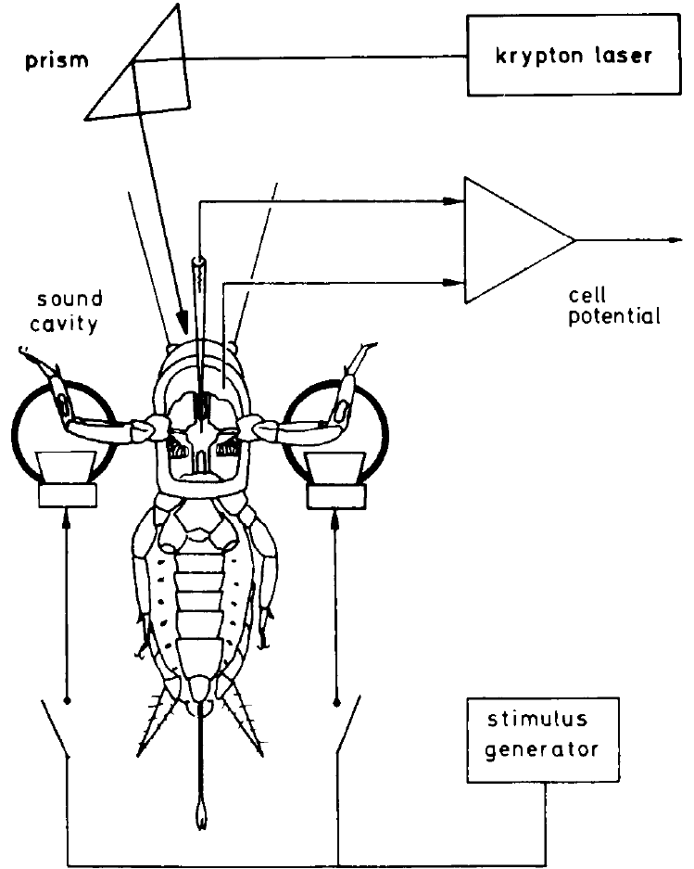
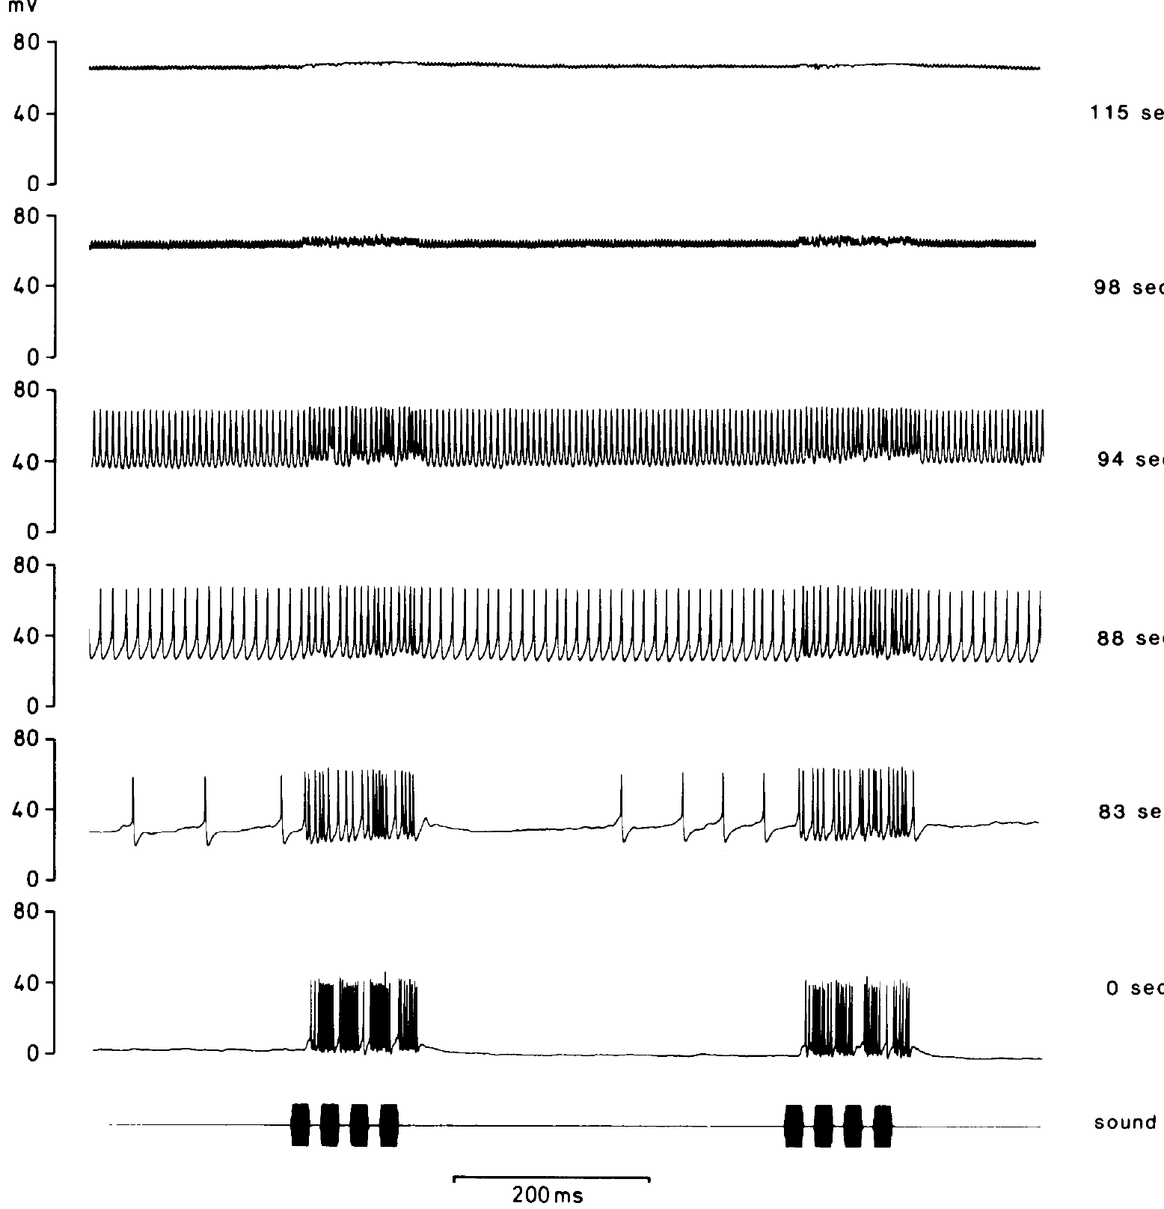
Photoinactivation tests a cell’s causal role
Photoinactivation selectively damages a dye-filled neuron by illuminating the preparation with intense light. Selverston and colleagues filled an identified auditory interneuron with Lucifer Yellow, then tested whether its loss changed the responses of another cell.
Female Gryllus bimaculatus received separate-ear, 5-kHz chirps through legphones. Laser irradiation at 5–50 mW progressively depolarized the stained neuron and abolished its activity. The acoustic preparation reduced cross-talk between ears by as much as 60 dB.
Comparing responses before and after loss provides causal evidence beyond anatomical overlap. A changed postsynaptic response can identify a required source of inhibition, provided the preparation remains functional. The experiment is strongest when the surviving neuron retains excitation to its usual input, because preserved responses indicate that irradiation did not destroy the entire auditory preparation.
Selverston et al. (1985), Fig. 2. Loss of activity during irradiation.
Selverston et al. (1985), Fig. 1. Legphones and selective photoinactivation.
Selverston et al. (1985)
16
Notes:
• **Photoinactivation** selectively damages a dye-filled neuron by illuminating the preparation with intense light. Selverston and colleagues filled an identified auditory interneuron with Lucifer Yellow, then tested whether its loss changed the responses of another cell.
• Female _Gryllus bimaculatus_ received separate-ear, 5-kHz chirps through legphones. Laser irradiation at 5–50 mW progressively depolarized the stained neuron and abolished its activity. The acoustic preparation reduced cross-talk between ears by as much as 60 dB.
• Comparing responses before and after loss provides causal evidence beyond anatomical overlap. A changed postsynaptic response can identify a required source of inhibition, provided the preparation remains functional. The experiment is strongest when the surviving neuron retains excitation to its usual input, because preserved responses indicate that irradiation did not destroy the entire auditory preparation.
• Ablation experiments are strongest when the surviving neuron retains excitation to its usual input. Preserved responses constrain the possibility that irradiation merely destroyed the entire auditory preparation.
References:
Selverston AI, Kleindienst HU, Huber F (1985). Synaptic connectivity between cricket auditory interneurons as studied by selective photoinactivation. Journal of Neuroscience 5(5):1283–1292. https://doi.org/10.1523/JNEUROSCI.05-05-01283.1985
Figure: Selverston et al. (1985), Fig. 1. Legphones and selective photoinactivation.
Figure source: https://doi.org/10.1523/JNEUROSCI.05-05-01283.1985
Figure: Selverston et al. (1985), Fig. 2. Loss of activity during irradiation.
Figure source: https://doi.org/10.1523/JNEUROSCI.05-05-01283.1985

Slide 24
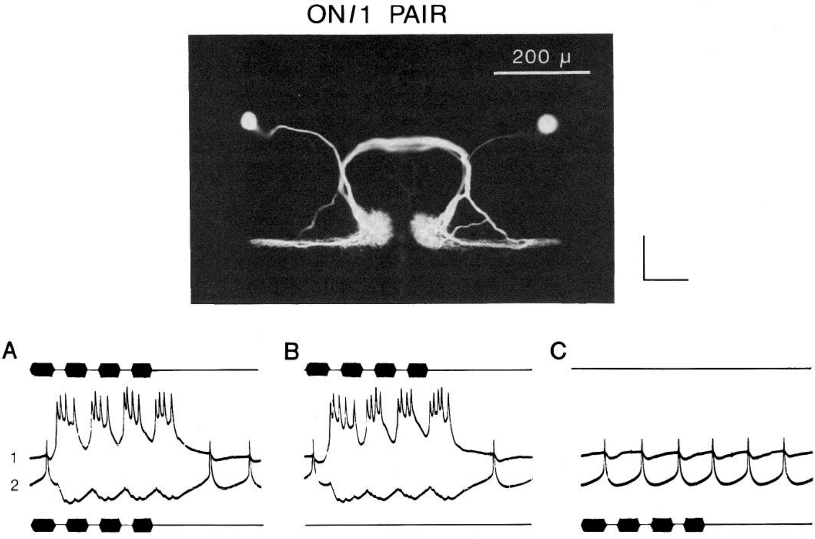
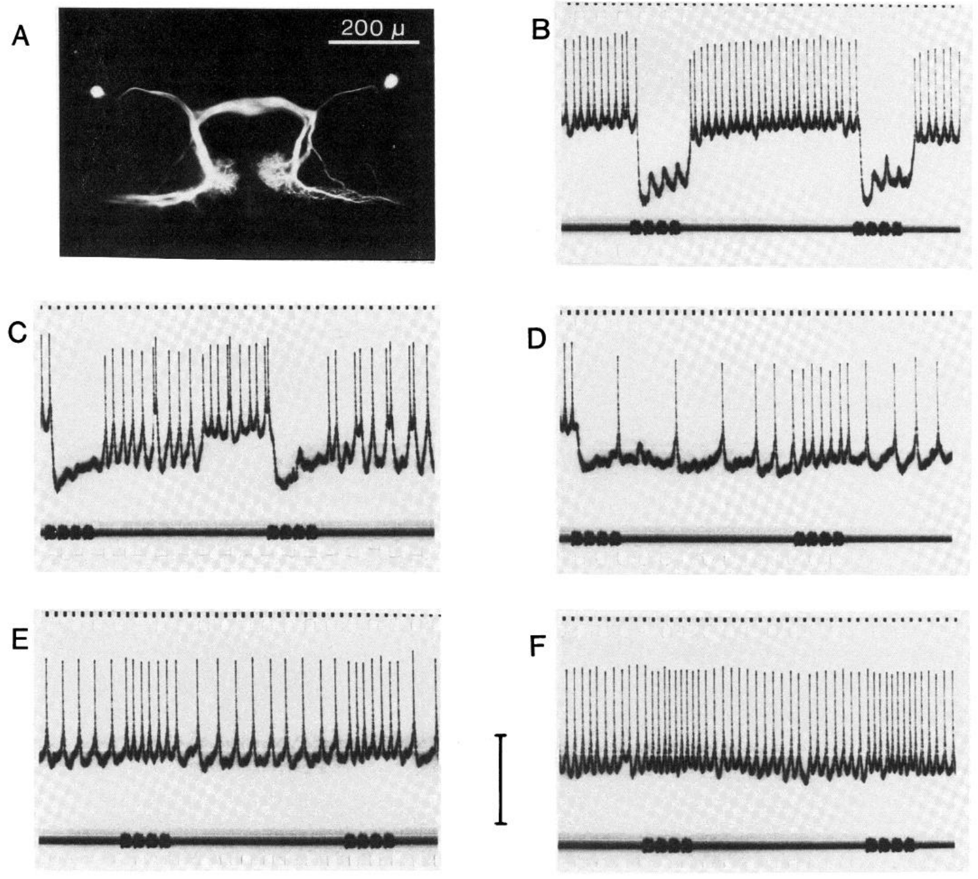
Omega cells provide reciprocal inhibition
Reciprocal inhibition means that each member of a neuronal pair inhibits the other. Selverston and colleagues combined simultaneous intracellular recording from paired ON1 cells with selective photoinactivation to test that organization directly.
Separate-ear, 5-kHz stimulation excited the corresponding ON1 and suppressed activity in its partner. After one stained ON1 was inactivated, the surviving cell lost its strong opposite-ear inhibitory response and a weak excitatory response became apparent.
The paired recordings and ablation support ON1 as a source of reciprocal suppression, sharpening the contrast between competing auditory inputs. The unmasked excitation means the opposite-ear pathway is not purely inhibitory. Removing inhibition reveals input that was previously obscured by the combined response, which separates the existence of a weak excitatory route from the dominance of reciprocal inhibition in the intact circuit.
Selverston et al. (1985), Fig. 4. Paired ON1 recordings.
Selverston et al. (1985), Fig. 7(A–F). ON1 ablation removes opposite-ear inhibition.
Selverston et al. (1985)
17
Notes:
• **Reciprocal inhibition** means that each member of a neuronal pair inhibits the other. Selverston and colleagues combined simultaneous intracellular recording from paired ON1 cells with selective photoinactivation to test that organization directly.
• Separate-ear, 5-kHz stimulation excited the corresponding ON1 and suppressed activity in its partner. After one stained ON1 was inactivated, the surviving cell lost its strong opposite-ear inhibitory response and a weak excitatory response became apparent.
• The paired recordings and ablation support ON1 as a source of reciprocal suppression, sharpening the contrast between competing auditory inputs. The unmasked excitation means the opposite-ear pathway is not purely inhibitory. Removing inhibition reveals input that was previously obscured by the combined response, which separates the existence of a weak excitatory route from the dominance of reciprocal inhibition in the intact circuit.
• Removing inhibition reveals input that was previously obscured by the combined response. That finding separates the existence of a weak excitatory route from the dominance of reciprocal inhibition in the intact circuit.
References:
Selverston AI, Kleindienst HU, Huber F (1985). Synaptic connectivity between cricket auditory interneurons as studied by selective photoinactivation. Journal of Neuroscience 5(5):1283–1292. https://doi.org/10.1523/JNEUROSCI.05-05-01283.1985
Figure: Selverston et al. (1985), Fig. 4. Paired ON1 recordings.
Figure source: https://doi.org/10.1523/JNEUROSCI.05-05-01283.1985
Figure: Selverston et al. (1985), Fig. 7(A–F). ON1 ablation removes opposite-ear inhibition.
Figure source: https://doi.org/10.1523/JNEUROSCI.05-05-01283.1985

Slide 25
Removing inhibition unmasks hidden excitation
Reciprocal inhibition means that each member of a neuronal pair inhibits the other. Selverston and colleagues recorded simultaneously from paired ON1 cells and selectively inactivated one of them with light, which tested the organization directly.
Separate-ear stimulation at 5 kHz excited the ON1 on the stimulated side and suppressed its partner. After one stained ON1 was inactivated, the surviving cell lost its strong opposite-ear inhibitory response, and a weak excitatory response became apparent.
The strong inhibition had been hiding that excitation in the combined response. Removing the inhibitory source therefore separates the existence of a weak excitatory route from the dominance of reciprocal inhibition in the intact circuit, and the inhibition sharpens the contrast between the two sides.
Selverston et al. (1985), Fig. 4. Paired ON1 recordings.
Selverston et al. (1985), Fig. 7(A–F). ON1 ablation removes opposite-ear inhibition.
Selverston et al. (1985)
17a
Notes:
• A manipulation that removes one source of input can reveal an input that was masked in the intact response.
• Reciprocal inhibition.
– Each ON1 of the pair inhibits the other, so the stimulated side suppresses its partner.
– The arrangement sharpens the contrast between competing auditory inputs.
• The manipulation.
– Photoinactivation selectively damages a dye-filled neuron by intense illumination.
– Selverston and colleagues compared the partner cell's responses before and after the loss.
• What was unmasked.
– The surviving ON1 lost its strong opposite-ear inhibition, and a weak excitatory response became apparent.
– The opposite-ear pathway is therefore not purely inhibitory.
• Controls.
– The acoustic preparation reduced cross-talk between ears by as much as 60 dB, and preserved responses in the surviving cell indicate that irradiation did not destroy the whole auditory preparation.
• Role in selectivity.
– Inhibition between the paired cells increases the contrast between the two sides, which supports the comparison of left and right auditory input.
– The recordings were made with simultaneous intracellular electrodes in both cells.
References:
Selverston AI, Kleindienst HU, Huber F (1985). Synaptic connectivity between cricket auditory interneurons as studied by selective photoinactivation. Journal of Neuroscience 5(5):1283–1292. https://doi.org/10.1523/JNEUROSCI.05-05-01283.1985

Slide 26
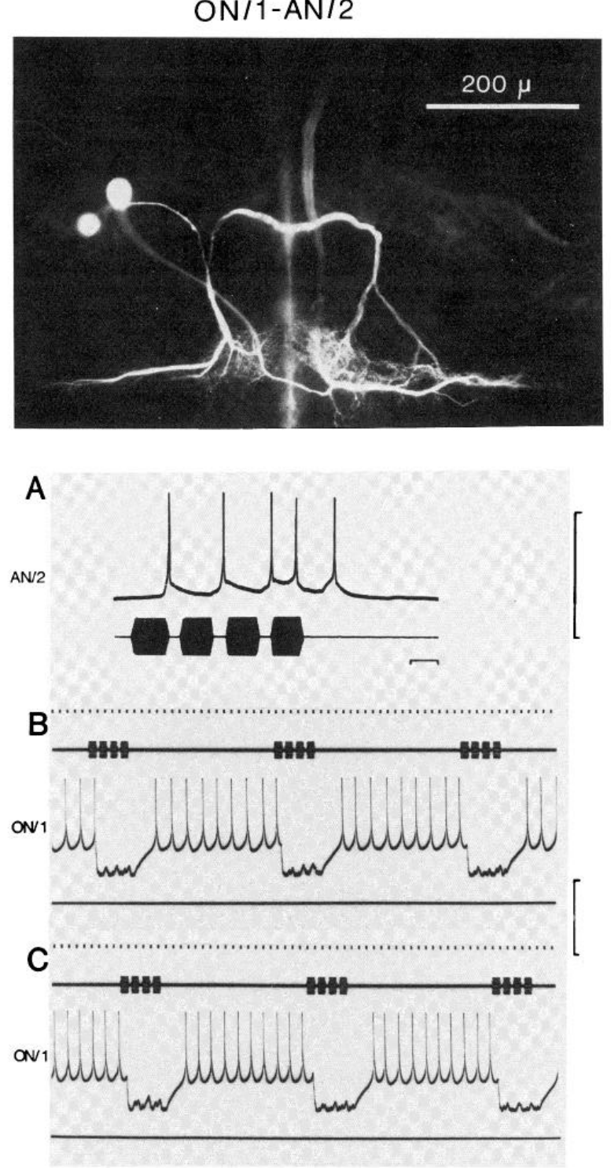
ON1 also supplies inhibition to an ascending cell
AN2 is an ascending auditory interneuron distinct from the calling-song pathway AN1. In the photoinactivation experiments, its response combined strong excitation from one ear with inhibition from stimulation on the cell-body side.
Selverston and colleagues recorded AN2 during separate-ear, 5-kHz chirps before and after damaging the ipsilateral ON1. The previously inhibitory response was replaced by weak excitation, while the neuron’s other acoustic responses could still be recorded.
This intervention identifies ON1 as a source of AN2 inhibition and supports a network in which local thoracic cells regulate ascending output. AN2 and AN1 are anatomically and physiologically distinct identified neurons, and the inference concerns the tested cell and the stimulus frequency used, so the experiment establishes an ON1–AN2 interaction in the thoracic ganglion.
Selverston et al. (1985), Fig. 11(A–C). ON1 ablation removes AN2 inhibition.
Selverston et al. (1985)
18
Notes:
• **AN2** is an ascending auditory interneuron distinct from the calling-song pathway AN1. In the photoinactivation experiments, its response combined strong excitation from one ear with inhibition from stimulation on the cell-body side.
• Selverston and colleagues recorded AN2 during separate-ear, 5-kHz chirps before and after damaging the ipsilateral ON1. The previously inhibitory response was replaced by weak excitation, while the neuron’s other acoustic responses could still be recorded.
• This intervention identifies ON1 as a source of AN2 inhibition and supports a network in which local thoracic cells regulate ascending output. AN2 and AN1 are anatomically and physiologically distinct identified neurons, and the inference concerns the tested cell and the stimulus frequency used, so the experiment establishes an ON1–AN2 interaction in the thoracic ganglion.
• AN2 and AN1 are anatomically and physiologically distinct identified neurons. The inference concerns the cell tested and the stimulus frequency used; it is not a complete connectome of the cricket auditory ganglion.
References:
Selverston AI, Kleindienst HU, Huber F (1985). Synaptic connectivity between cricket auditory interneurons as studied by selective photoinactivation. Journal of Neuroscience 5(5):1283–1292. https://doi.org/10.1523/JNEUROSCI.05-05-01283.1985
Figure: Selverston et al. (1985), Fig. 11(A–C). ON1 ablation removes AN2 inhibition.
Figure source: https://doi.org/10.1523/JNEUROSCI.05-05-01283.1985

Slide 27
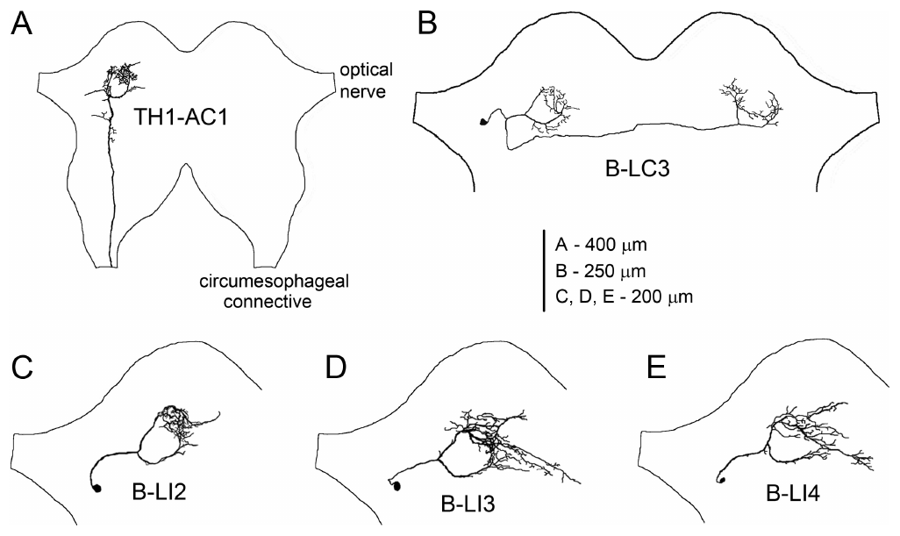
Brain neurons branch near AN1 terminals
The anterior protocerebrum is a front region of the cricket brain containing terminals of the ascending auditory pathway. Kostarakos and Hedwig identified local brain cells whose ring-like branches overlapped that termination area in female Gryllus bimaculatus.
Intracellular recordings were followed by dye labeling while synthetic 4.8-kHz chirps varied in duration, interval and period. Their labels B-LI2, B-LI3 and B-LI4 correspond to LN2, LN3 and LN4 in the later circuit study; B-LC3 connected the auditory regions across the midline.
Different response selectivities occurred among cells occupying the same local region. The anatomy supports a compact substrate for processing temporal patterns, while the recorded tuning distinguishes information copying from recognition-related filtering. B-LC3 connected the auditory processing regions on the two sides of the brain, whereas the nonspiking LN5 was newly identified in the later study.
Kostarakos & Hedwig (2012), Fig. 1(A–E). Ascending and local brain neurons.
Kostarakos & Hedwig (2012), Fig. 6. Published behavior and neuronal response heat maps.
Kostarakos & Hedwig (2012)
19
Notes:
• The **anterior protocerebrum** is a front region of the cricket brain containing terminals of the ascending auditory pathway. Kostarakos and Hedwig identified local brain cells whose ring-like branches overlapped that termination area in female _Gryllus bimaculatus_.
• Intracellular recordings were followed by dye labeling while synthetic 4.8-kHz chirps varied in duration, interval and period. Their labels B-LI2, B-LI3 and B-LI4 correspond to LN2, LN3 and LN4 in the later circuit study; B-LC3 connected the auditory regions across the midline.
• Different response selectivities occurred among cells occupying the same local region. The anatomy supports a compact substrate for processing temporal patterns, while the recorded tuning distinguishes information copying from recognition-related filtering. B-LC3 connected the auditory processing regions on the two sides of the brain, whereas the nonspiking LN5 was newly identified in the later study.
• The B-LC3 commissural projection links auditory processing areas on the two sides. It should not be treated as identical to the later nonspiking LN5, which was newly identified in the 2015 study.
References:
Kostarakos K, Hedwig B (2012). Calling song recognition in female crickets: temporal tuning of identified brain neurons matches behavior. Journal of Neuroscience 32(28):9601–9612. https://doi.org/10.1523/JNEUROSCI.1170-12.2012
Figure: Kostarakos & Hedwig (2012), Fig. 1(A–E). Ascending and local brain neurons.
Figure source: https://doi.org/10.1523/JNEUROSCI.1170-12.2012
Figure: Kostarakos & Hedwig (2012), Fig. 6. Published behavior and neuronal response heat maps.
Figure source: https://doi.org/10.1523/JNEUROSCI.1170-12.2012

Slide 28
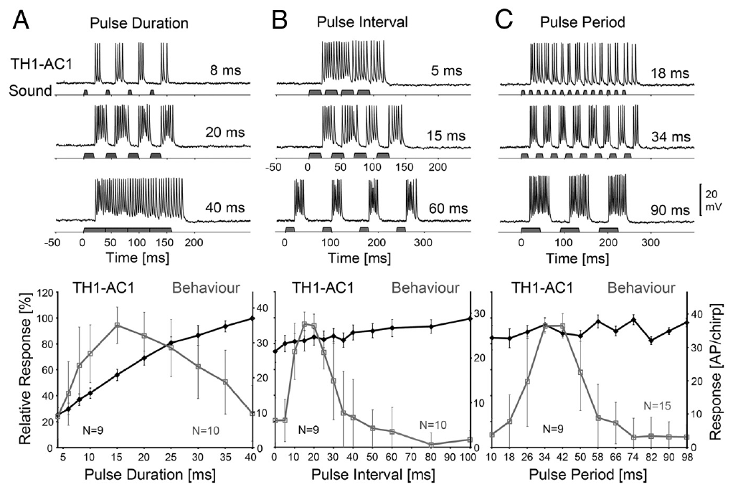
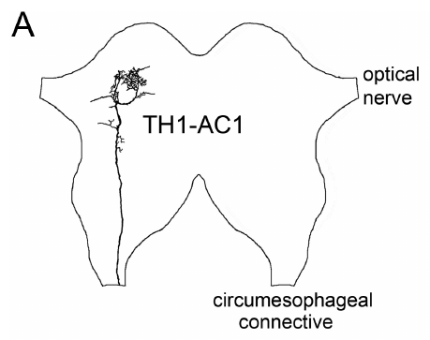
AN1 spike count does not encode attractiveness
An action potential is a brief regenerative electrical spike that can transmit activity along an axon. Kostarakos and Hedwig counted AN1 action potentials per chirp and compared them with phonotactic steering elicited by the same temporal stimulus classes.
Increasing pulse duration from 8 to 20 to 40 ms increased AN1 output from approximately 14 to 26 to 37 spikes per chirp. Behavioral attraction instead peaked near 15-ms pulses and decreased toward longer durations under this stimulus paradigm.
The divergence means that total ascending spike count is insufficient to explain female preference. Later processing must distinguish the temporal organization carried by AN1. At the 40-ms setting adjacent sound intervals disappeared and the stimulus became continuous within the chirp, so the large AN1 response to that stimulus is a response to continuous sound, whereas natural song is pulsed.
Kostarakos & Hedwig (2012), Fig. 2(A–C). AN1 activity and behavioral tuning.
Kostarakos & Hedwig (2012), Fig. 1(A). AN1 projection (400 μm common scale).
Kostarakos & Hedwig (2012)
20
Notes:
• An **action potential** is a brief regenerative electrical spike that can transmit activity along an axon. Kostarakos and Hedwig counted AN1 action potentials per chirp and compared them with phonotactic steering elicited by the same temporal stimulus classes.
• Increasing pulse duration from 8 to 20 to 40 ms increased AN1 output from approximately 14 to 26 to 37 spikes per chirp. Behavioral attraction instead peaked near 15-ms pulses and decreased toward longer durations under this stimulus paradigm.
• The divergence means that total ascending spike count is insufficient to explain female preference. Later processing must distinguish the temporal organization carried by AN1. At the 40-ms setting adjacent sound intervals disappeared and the stimulus became continuous within the chirp, so the large AN1 response to that stimulus is a response to continuous sound, whereas natural song is pulsed.
• At the 40-ms setting, adjacent sound intervals disappeared and the stimulus became continuous within the chirp. A large response to that continuous input cannot be equated with recognition of a natural pulsed song.
References:
Kostarakos K, Hedwig B (2012). Calling song recognition in female crickets: temporal tuning of identified brain neurons matches behavior. Journal of Neuroscience 32(28):9601–9612. https://doi.org/10.1523/JNEUROSCI.1170-12.2012
Figure: Kostarakos & Hedwig (2012), Fig. 2(A–C). AN1 activity and behavioral tuning.
Figure source: https://doi.org/10.1523/JNEUROSCI.1170-12.2012
Figure: Kostarakos & Hedwig (2012), Fig. 1(A). AN1 projection (400 μm common scale).
Figure source: https://doi.org/10.1523/JNEUROSCI.1170-12.2012

Slide 29
Spike count and attractiveness are different readouts
A neuron's output over a chirp can be summarized as a spike count, and a female's response can be summarized as steering toward the sound. The two readouts match only if the neuron's total activity measures how attractive the song is.
Kostarakos and Hedwig increased pulse duration from 8 to 20 to 40 ms, and AN1 output rose from approximately 14 to 26 to 37 spikes per chirp. Behavioral attraction peaked near 15-ms pulses and decreased toward longer durations.
AN1 therefore responds more to more sound, whereas the female responds most to a specific temporal pattern. Total ascending spike count is insufficient to explain preference, and later processing must extract the temporal organization carried by AN1.
Kostarakos & Hedwig (2012), Fig. 2(A–C). AN1 activity and behavioral tuning.
Kostarakos & Hedwig (2012), Fig. 1(A). AN1 projection (400 μm common scale).
Kostarakos & Hedwig (2012)
20a
Notes:
• When a neuron's output rises and the behavior does not, the neuron is supplying information that later stages must still interpret.
• Two readouts.
– An action potential is a brief regenerative electrical spike that can transmit activity along an axon.
– Kostarakos and Hedwig counted AN1 spikes per chirp and compared them with steering elicited by the same temporal stimulus classes.
• Opposite trends.
– AN1 output increased from approximately 14 to 26 to 37 spikes per chirp as pulse duration increased from 8 to 20 to 40 ms.
– Behavioral attraction instead peaked near 15 ms and declined toward longer durations.
• What changes at 40 ms.
– At 40 ms the sound intervals disappear and the stimulus becomes continuous within the chirp.
– A large response to a continuous stimulus is a response to sound, whereas natural song is pulsed.
• The inference.
– The comparison supports a transformation of the input representation between AN1 and the behavior.
References:
Kostarakos K, Hedwig B (2012). Calling song recognition in female crickets: temporal tuning of identified brain neurons matches behavior. Journal of Neuroscience 32(28):9601–9612. https://doi.org/10.1523/JNEUROSCI.1170-12.2012

Slide 30
Brain neurons filter pulse duration
Pulse duration specifies how long sound remains on during each pulse. Kostarakos and Hedwig varied this duration while maintaining a 40-ms pulse period, so longer pulses necessarily reduced the silent interval and changed both aspects of the temporal pattern.
At 4.8 kHz, early local neuron B-LI2 continued to copy many patterns, whereas B-LI4 exhibited a more selective response that broadly matched phonotaxis. B-LI4 received inhibition as well as excitation, and unattractive patterns could produce strong inhibition rather than reliable spiking.
The findings place temporal selectivity within brain processing rather than in AN1’s total activity. Duration and silence covaried in this paradigm, so the response regions in the duration–interval heat maps are interpreted together with the interval and period experiments, and B-LI4's tuning is compatible with a recognition function.
Kostarakos & Hedwig (2012), Fig. 6. Published behavior and neuronal response heat maps.
Kostarakos & Hedwig (2012)
21
Notes:
• **Pulse duration** specifies how long sound remains on during each pulse. Kostarakos and Hedwig varied this duration while maintaining a 40-ms pulse period, so longer pulses necessarily reduced the silent interval and changed both aspects of the temporal pattern.
• At 4.8 kHz, early local neuron B-LI2 continued to copy many patterns, whereas B-LI4 exhibited a more selective response that broadly matched phonotaxis. B-LI4 received inhibition as well as excitation, and unattractive patterns could produce strong inhibition rather than reliable spiking.
• The findings place temporal selectivity within brain processing rather than in AN1’s total activity. Duration and silence covaried in this paradigm, so the response regions in the duration–interval heat maps are interpreted together with the interval and period experiments, and B-LI4's tuning is compatible with a recognition function.
• The published heat maps include neuron reconstructions and allow duration–interval response regions to be compared. B-LI4’s tuning is compatible with recognition, but matching a behavioral curve is not a lesion test of necessity.
References:
Kostarakos K, Hedwig B (2012). Calling song recognition in female crickets: temporal tuning of identified brain neurons matches behavior. Journal of Neuroscience 32(28):9601–9612. https://doi.org/10.1523/JNEUROSCI.1170-12.2012
Figure: Kostarakos & Hedwig (2012), Fig. 6. Published behavior and neuronal response heat maps.
Figure source: https://doi.org/10.1523/JNEUROSCI.1170-12.2012

Slide 31
Paired pulses reveal interval selectivity
A temporal band-pass response favors an intermediate range of timing values and weakens at both shorter and longer values. Kostarakos and Hedwig tested local brain cells with 20-ms pulses separated by different silent intervals.
B-LI4 responded particularly strongly when the second pulse followed a species-appropriate interval near 20 ms. Other local neurons responded to a wider range of timings, including patterns that produced little phonotaxis. The stimulus carrier remained 4.8 kHz.
Selectivity can therefore emerge by the second pulse rather than requiring an entire long song phrase. The interaction of excitation and inhibition during the interval is consistent with a short temporal computation. A two-pulse test separates the first response from the effect that the first pulse leaves on the processing of the second, which motivated later experiments on delayed excitation and postinhibitory rebound.
Kostarakos & Hedwig (2012), Fig. 6. Published behavior and neuronal response heat maps.
Kostarakos & Hedwig (2012)
22
Notes:
• A **temporal band-pass response** favors an intermediate range of timing values and weakens at both shorter and longer values. Kostarakos and Hedwig tested local brain cells with 20-ms pulses separated by different silent intervals.
• B-LI4 responded particularly strongly when the second pulse followed a species-appropriate interval near 20 ms. Other local neurons responded to a wider range of timings, including patterns that produced little phonotaxis. The stimulus carrier remained 4.8 kHz.
• Selectivity can therefore emerge by the second pulse rather than requiring an entire long song phrase. The interaction of excitation and inhibition during the interval is consistent with a short temporal computation. A two-pulse test separates the first response from the effect that the first pulse leaves on the processing of the second, which motivated later experiments on delayed excitation and postinhibitory rebound.
• A two-pulse test separates the first response from the effect that the first pulse leaves on processing the second. That distinction motivated later experiments on delayed excitation and postinhibitory rebound.
References:
Kostarakos K, Hedwig B (2012). Calling song recognition in female crickets: temporal tuning of identified brain neurons matches behavior. Journal of Neuroscience 32(28):9601–9612. https://doi.org/10.1523/JNEUROSCI.1170-12.2012
Figure: Kostarakos & Hedwig (2012), Fig. 6. Published behavior and neuronal response heat maps.
Figure source: https://doi.org/10.1523/JNEUROSCI.1170-12.2012

Slide 32
Constant-energy tests reveal period selectivity
Pulse period combines sound duration and the following silent interval. Kostarakos and Hedwig used a constant-sound-energy paradigm in which pulse number and duration were adjusted to avoid making a more attractive timing pattern simply deliver more total sound.
Female phonotaxis was strongest around 34–42 ms and declined toward shorter and longer periods. AN1’s spike output did not reproduce this band-pass profile, whereas the local B-LI4 response more closely matched behavioral selectivity across the tested periods.
Controlling acoustic energy strengthens the interpretation that temporal structure contributes to attraction. Total energy and temporal pattern are different stimulus properties, and adjusting pulse number and duration prevents their simple confounding while B-LI4 matched the behavioral band-pass profile more closely than AN1, which supports a recognition-related output stage.
Kostarakos & Hedwig (2012), Fig. 6. Published behavior and neuronal response heat maps.
Kostarakos & Hedwig (2012)
23
Notes:
• **Pulse period** combines sound duration and the following silent interval. Kostarakos and Hedwig used a constant-sound-energy paradigm in which pulse number and duration were adjusted to avoid making a more attractive timing pattern simply deliver more total sound.
• Female phonotaxis was strongest around 34–42 ms and declined toward shorter and longer periods. AN1’s spike output did not reproduce this band-pass profile, whereas the local B-LI4 response more closely matched behavioral selectivity across the tested periods.
• Controlling acoustic energy strengthens the interpretation that temporal structure contributes to attraction. Total energy and temporal pattern are different stimulus properties, and adjusting pulse number and duration prevents their simple confounding while B-LI4 matched the behavioral band-pass profile more closely than AN1, which supports a recognition-related output stage.
• Total energy and temporal pattern are different stimulus properties. Adjusting the stimulus prevents their simple confounding but does not remove the need to specify which pulse widths and pauses were used at each period.
References:
Kostarakos K, Hedwig B (2012). Calling song recognition in female crickets: temporal tuning of identified brain neurons matches behavior. Journal of Neuroscience 32(28):9601–9612. https://doi.org/10.1523/JNEUROSCI.1170-12.2012
Figure: Kostarakos & Hedwig (2012), Fig. 6. Published behavior and neuronal response heat maps.
Figure source: https://doi.org/10.1523/JNEUROSCI.1170-12.2012

Slide 33
Constant-energy stimuli separate pattern from loudness
A more attractive pulse pattern could simply deliver more sound. Kostarakos and Hedwig therefore used a constant-sound-energy paradigm in which pulse number and duration were adjusted so that every pulse period delivered the same total sound energy.
Female phonotaxis was strongest at pulse periods around 34–42 ms and declined toward shorter and longer periods, a band-pass profile. AN1 spike output did not reproduce that profile, whereas the local neuron B-LI4 matched the behavioral selectivity across the tested periods.
Total energy and temporal pattern are different stimulus properties, and holding energy constant prevents them from being confounded. The agreement between B-LI4 and behavior supports a recognition-related output stage in the brain.
Kostarakos & Hedwig (2012), Fig. 6. Published behavior and neuronal response heat maps.
Kostarakos & Hedwig (2012)
23a
Notes:
• Equalizing total sound energy tests whether the temporal pattern, and not the amount of sound, drives the response.
• The control.
– Pulse number and duration were adjusted so that a more attractive timing pattern did not simply deliver more total sound.
– Total energy and temporal pattern are different stimulus properties.
• Band-pass behavior.
– Pulse period combines sound duration and the following silent interval.
– Phonotaxis was strongest around 34–42 ms and declined at shorter and longer periods.
• Neurons compared with behavior.
– AN1 spike output did not show the band-pass profile.
– The local neuron B-LI4 matched the behavioral selectivity more closely across the tested periods.
• What the control leaves open.
– The paradigm still requires the specific pulse widths and pauses used at each period to be specified, and the neural and behavioral tuning are matched measurements.
• Tuning compared with behavior.
– The comparison used the responses of AN1 and B-LI4 across the tested pulse periods, so each neuron's tuning can be set beside the behavioral curve.
References:
Kostarakos K, Hedwig B (2012). Calling song recognition in female crickets: temporal tuning of identified brain neurons matches behavior. Journal of Neuroscience 32(28):9601–9612. https://doi.org/10.1523/JNEUROSCI.1170-12.2012

Slide 34
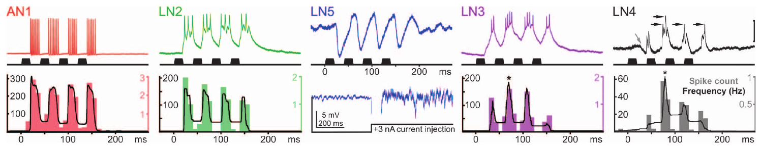
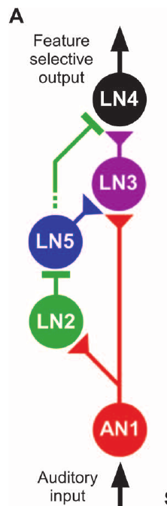
The second pulse recruits a different brain response
Schöneich and colleagues recorded the ascending neuron AN1 and four local brain cells during standard 4.8-kHz chirps. The chirps contained four 20-ms sound pulses separated by 20-ms silent intervals, providing repeated opportunities for interaction between successive responses.
AN1 and LN2 produced their strongest responses to the first pulse and adapted somewhat over the chirp. LN3 and LN4 responded most strongly to the second pulse; LN4 often failed to spike to the first despite receiving synaptic input.
The contrasting sequences support a transformation of sensory copying into timing-dependent output. A nonspiking neuron, LN5, changed membrane voltage without generating action potentials even during depolarizing current injection. Its graded response provides a distinct candidate mechanism for carrying temporally delayed information within the local brain circuit.
Schöneich et al. (2015), Fig. 2. Responses across the five-neuron auditory pathway.
Schöneich et al. (2015), Fig. 5(A). Proposed auditory circuit.
Schöneich et al. (2015)
24
Notes:
• Schöneich and colleagues recorded the ascending neuron AN1 and four local brain cells during standard 4.8-kHz chirps. The chirps contained four 20-ms sound pulses separated by 20-ms silent intervals, providing repeated opportunities for interaction between successive responses.
• AN1 and LN2 produced their strongest responses to the first pulse and adapted somewhat over the chirp. LN3 and LN4 responded most strongly to the second pulse; LN4 often failed to spike to the first despite receiving synaptic input.
• The contrasting sequences support a transformation of sensory copying into timing-dependent output. A **nonspiking neuron**, LN5, changed membrane voltage without generating action potentials even during depolarizing current injection. Its graded response provides a distinct candidate mechanism for carrying temporally delayed information within the local brain circuit.
• The recordings were obtained from different specimens and aligned to stimulus onset. Their plotted timing supports the proposed circuit, but the aligned traces are not simultaneous recordings of all five neurons.
References:
Schöneich S, Kostarakos K, Hedwig B (2015). An auditory feature detection circuit for sound pattern recognition. Science Advances 1(8):e1500325. https://doi.org/10.1126/sciadv.1500325
Figure: Schöneich et al. (2015), Fig. 2. Responses across the five-neuron auditory pathway.
Figure source: https://doi.org/10.1126/sciadv.1500325
Figure: Schöneich et al. (2015), Fig. 5(A). Proposed auditory circuit.
Figure source: https://doi.org/10.1126/sciadv.1500325

Slide 35
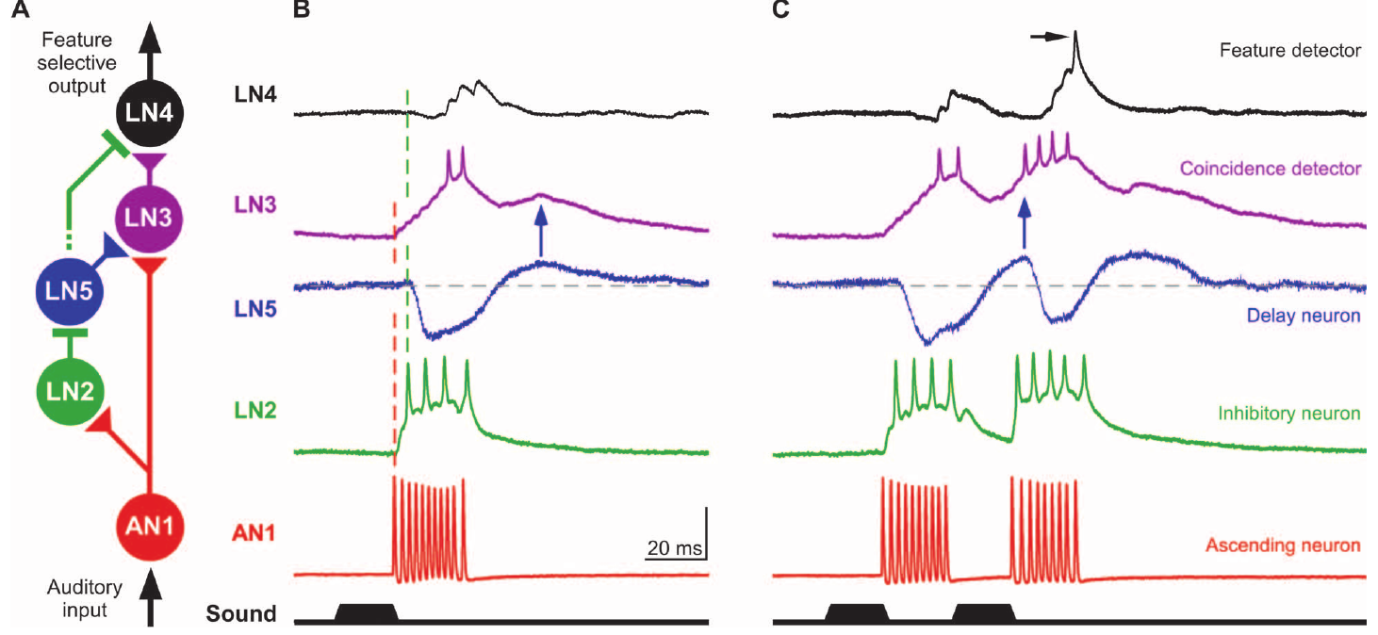
AN1 supplies fast excitation in the brain
In the proposed recognition circuit, AN1 supplies a direct excitatory pathway to local neurons LN2 and LN3. An EPSP is a depolarizing postsynaptic response; successive EPSPs can sum until a neuron crosses its spike threshold.
At 75 dB SPL, AN1’s brain response began about 20 ms after sound onset. LN2’s EPSPs began at approximately the same latency, and two large EPSPs were sufficient to trigger its spikes. LN3 required summation of roughly five or six smaller EPSPs.
Different integration requirements allow the same ascending pulse representation to produce different output timing. The inference of direct excitation rests on response latencies, frequency tuning and EPSP structure. SPL is sound pressure level referenced to 20 μPa, so the latency comparisons refer to a calibrated acoustic stimulus, and the network diagram is the authors' evidence-based proposal built from these latencies.
Schöneich et al. (2015), Fig. 5(A–C). Proposed connections and measured response timing.
Schöneich et al. (2015)
25
Notes:
• In the proposed recognition circuit, AN1 supplies a direct excitatory pathway to local neurons LN2 and LN3. An **EPSP** is a depolarizing postsynaptic response; successive EPSPs can sum until a neuron crosses its spike threshold.
• At 75 dB SPL, AN1’s brain response began about 20 ms after sound onset. LN2’s EPSPs began at approximately the same latency, and two large EPSPs were sufficient to trigger its spikes. LN3 required summation of roughly five or six smaller EPSPs.
• Different integration requirements allow the same ascending pulse representation to produce different output timing. The inference of direct excitation rests on response latencies, frequency tuning and EPSP structure. SPL is sound pressure level referenced to 20 μPa, so the latency comparisons refer to a calibrated acoustic stimulus, and the network diagram is the authors' evidence-based proposal built from these latencies.
• SPL means sound pressure level, referenced in these experiments to 20 μPa. The latency comparisons refer to a calibrated acoustic stimulus and do not imply that all cells have identical membrane properties.
References:
Schöneich S, Kostarakos K, Hedwig B (2015). An auditory feature detection circuit for sound pattern recognition. Science Advances 1(8):e1500325. https://doi.org/10.1126/sciadv.1500325
Figure: Schöneich et al. (2015), Fig. 5(A–C). Proposed connections and measured response timing.
Figure source: https://doi.org/10.1126/sciadv.1500325

Slide 36
LN2 provides a rapid inhibitory branch
LN2 is a local spiking brain interneuron whose activity closely follows the ascending acoustic input. Its response precedes inhibition in both the nonspiking delay neuron LN5 and the selective output neuron LN4 in the proposed network.
LN2 spiked approximately 23 ms after sound onset, while LN4 and LN5 began inhibitory responses near 25 ms. Above about 50 dB SPL, LN2 output was relatively insensitive to further increases in sound intensity, unlike AN1’s more intensity-dependent activity.
This timing and shared intensity dependence support LN2 as the inhibitory branch linking acoustic input to the two downstream cells. The recordings establish inhibitory responses in LN4 and LN5 physiologically, and a similar dependence on sound intensity supports the circuit relationship that the authors present as an evidence-based proposal.
Schöneich et al. (2015), Fig. 5(A–C). Proposed connections and measured response timing.
Schöneich et al. (2015)
26
Notes:
• **LN2** is a local spiking brain interneuron whose activity closely follows the ascending acoustic input. Its response precedes inhibition in both the nonspiking delay neuron LN5 and the selective output neuron LN4 in the proposed network.
• LN2 spiked approximately 23 ms after sound onset, while LN4 and LN5 began inhibitory responses near 25 ms. Above about 50 dB SPL, LN2 output was relatively insensitive to further increases in sound intensity, unlike AN1’s more intensity-dependent activity.
• This timing and shared intensity dependence support LN2 as the inhibitory branch linking acoustic input to the two downstream cells. The recordings establish inhibitory responses in LN4 and LN5 physiologically, and a similar dependence on sound intensity supports the circuit relationship that the authors present as an evidence-based proposal.
• A similar dependence on sound intensity can support a circuit relationship, but it is not equivalent to manipulating the presynaptic neuron while recording a unitary postsynaptic response. The network diagram is the authors’ evidence-based proposal.
References:
Schöneich S, Kostarakos K, Hedwig B (2015). An auditory feature detection circuit for sound pattern recognition. Science Advances 1(8):e1500325. https://doi.org/10.1126/sciadv.1500325
Figure: Schöneich et al. (2015), Fig. 5(A–C). Proposed connections and measured response timing.
Figure source: https://doi.org/10.1126/sciadv.1500325

Slide 37
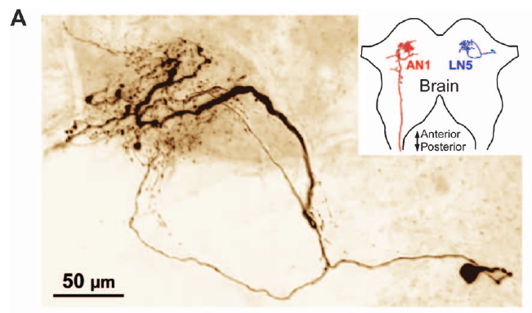
LN5 is an identified nonspiking delay-line neuron
LN5 has a ventrolateral cell body and branches near AN1’s terminals in the anterior protocerebrum. Its anatomical location places it within the local auditory network rather than in the thoracic sensory ganglion or a long ascending tract.
Schöneich and colleagues recorded sound-evoked hyperpolarization followed by depolarization in LN5. Standard 20-ms pulses produced inhibition of approximately 4–9 mV and a later depolarization of 3–5 mV above rest. Depolarizing current injection did not evoke spikes.
These properties distinguish a graded local signal from an axonal spike train. Hyperpolarization makes the recorded membrane voltage more negative and depolarization makes it less negative, so a nonspiking interneuron can communicate through graded membrane changes, and the delayed depolarization can contribute excitation to later circuit processing.
Schöneich et al. (2015), Fig. 4(A). LN5 anatomy (50 μm).
Schöneich et al. (2015)
27
Notes:
• **LN5** has a ventrolateral cell body and branches near AN1’s terminals in the anterior protocerebrum. Its anatomical location places it within the local auditory network rather than in the thoracic sensory ganglion or a long ascending tract.
• Schöneich and colleagues recorded sound-evoked hyperpolarization followed by depolarization in LN5. Standard 20-ms pulses produced inhibition of approximately 4–9 mV and a later depolarization of 3–5 mV above rest. Depolarizing current injection did not evoke spikes.
• These properties distinguish a graded local signal from an axonal spike train. Hyperpolarization makes the recorded membrane voltage more negative and depolarization makes it less negative, so a nonspiking interneuron can communicate through graded membrane changes, and the delayed depolarization can contribute excitation to later circuit processing.
• Hyperpolarization makes the recorded membrane voltage more negative, whereas depolarization makes it less negative. A nonspiking interneuron can communicate through graded membrane changes even though the study did not resolve the molecular mechanism of its output.
References:
Schöneich S, Kostarakos K, Hedwig B (2015). An auditory feature detection circuit for sound pattern recognition. Science Advances 1(8):e1500325. https://doi.org/10.1126/sciadv.1500325
Figure: Schöneich et al. (2015), Fig. 4(A). LN5 anatomy (50 μm).
Figure source: https://doi.org/10.1126/sciadv.1500325

Slide 38
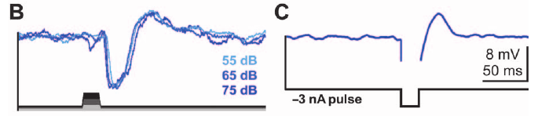
Release from inhibition generates rebound
Postinhibitory rebound is a depolarization occurring after inhibition ends. A delayed excitatory synaptic input could produce a superficially similar waveform, so Schöneich and colleagues tested whether LN5 could rebound when the auditory stimulus was replaced by injected current.
A 20-ms hyperpolarizing current pulse of −3 nA produced a 3–5-mV depolarization after release. Sound pulses at 55, 65 and 75 dB SPL also elicited similar rebound responses despite differences in stimulus intensity.
The current-injection control supports an intrinsic membrane contribution to the delayed signal rather than requiring delayed acoustic excitation alone. Injecting current changes the recorded cell's voltage without reproducing the entire auditory network input, so rebound after this manipulation separates a membrane property from a delay that would depend exclusively on another neuron's late response.
Schöneich et al. (2015), Fig. 4(B–C). Sound and injected current evoke rebound.
Schöneich et al. (2015), Fig. 4(A). LN5 anatomy (50 μm).
Schöneich et al. (2015)
28
Notes:
• **Postinhibitory rebound** is a depolarization occurring after inhibition ends. A delayed excitatory synaptic input could produce a superficially similar waveform, so Schöneich and colleagues tested whether LN5 could rebound when the auditory stimulus was replaced by injected current.
• A 20-ms hyperpolarizing current pulse of −3 nA produced a 3–5-mV depolarization after release. Sound pulses at 55, 65 and 75 dB SPL also elicited similar rebound responses despite differences in stimulus intensity.
• The current-injection control supports an intrinsic membrane contribution to the delayed signal rather than requiring delayed acoustic excitation alone. Injecting current changes the recorded cell's voltage without reproducing the entire auditory network input, so rebound after this manipulation separates a membrane property from a delay that would depend exclusively on another neuron's late response.
• Injecting current changes the recorded cell’s voltage without reproducing the entire auditory network input. Rebound after this manipulation separates a membrane property from a delay that would depend exclusively on another neuron’s late response.
References:
Schöneich S, Kostarakos K, Hedwig B (2015). An auditory feature detection circuit for sound pattern recognition. Science Advances 1(8):e1500325. https://doi.org/10.1126/sciadv.1500325
Figure: Schöneich et al. (2015), Fig. 4(B–C). Sound and injected current evoke rebound.
Figure source: https://doi.org/10.1126/sciadv.1500325
Figure: Schöneich et al. (2015), Fig. 4(A). LN5 anatomy (50 μm).
Figure source: https://doi.org/10.1126/sciadv.1500325

Slide 39
Postinhibitory rebound arises after release
Postinhibitory rebound is a depolarization that occurs after inhibition ends. A delayed excitatory synaptic input could produce a similar waveform, so the source of the depolarization has to be tested by removing the sound and injecting current instead.
Schöneich and colleagues applied a 20-ms hyperpolarizing current pulse of −3 nA to LN5, and the cell produced a depolarization of 3–5 mV after the current ended. Sound pulses at 55, 65 and 75 dB SPL also elicited similar rebound responses despite the differences in stimulus intensity.
Injecting current changes the recorded cell's voltage without reproducing the input of the auditory network. Rebound under that manipulation indicates that the delayed depolarization has an intrinsic membrane contribution and does not depend only on a late excitatory input from another neuron.
Schöneich et al. (2015), Fig. 4(B–C). Sound and injected current evoke rebound.
Schöneich et al. (2015), Fig. 4(A). LN5 anatomy (50 μm).
Schöneich et al. (2015)
28a
Notes:
• A current-injection control distinguishes a property of the recorded membrane from a delayed synaptic input.
• The two possible sources.
– A delayed excitatory synaptic input could produce a waveform that resembles rebound.
– An intrinsic membrane property would also produce depolarization after hyperpolarization.
• The test.
– A 20-ms hyperpolarizing current pulse of −3 nA produced a 3–5 mV depolarization after release.
– Sound pulses at three intensities elicited a similar rebound.
• What the control isolates.
– Injecting current changes the voltage of the recorded cell without reproducing the network input.
– The rebound after current injection separates a membrane property from a delay that depends on another neuron's late response.
• The physiological result.
– The sequence is inhibition, release, rebound and delayed excitation, and the cell's voltage response establishes the physiological mechanism more directly than the identity of a channel.
• Why rebound can time a delay.
– The rebound begins when inhibition ends, so its timing is tied to the end of a pulse.
– That offset-linked timing allows the depolarization to align with excitation from a following pulse.
References:
Schöneich S, Kostarakos K, Hedwig B (2015). An auditory feature detection circuit for sound pattern recognition. Science Advances 1(8):e1500325. https://doi.org/10.1126/sciadv.1500325

Slide 40
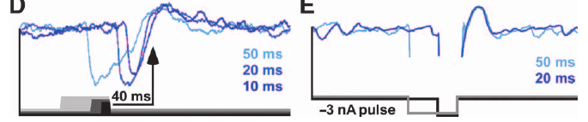
Rebound timing follows sound offset
A delay may be coupled to sound onset or to sound offset, and these alternatives predict different effects when pulse duration changes. LN5’s rebound was linked to release from hyperpolarization rather than to a fixed time after the initial acoustic event.
Schöneich and colleagues varied sound-pulse and current-pulse duration. Across the tested acoustic durations of 10–50 ms, the rebound peaked approximately 43 ms after sound offset. Current-evoked rebound likewise followed the end of the imposed hyperpolarization.
The delayed signal therefore marks the transition out of inhibition and can align with excitation produced by a following pulse. This is a cellular timing operation, not merely conduction through a longer axon. Changing pulse duration while aligning responses to offset tests the origin of the delay: an offset-linked membrane process peaks at a delay that follows the end of each pulse, whereas an onset-linked timer would peak at the same absolute delay for every pulse.
Schöneich et al. (2015), Fig. 4(D–E). Rebound follows release from inhibition.
Schöneich et al. (2015), Fig. 4(A). LN5 anatomy (50 μm).
Schöneich et al. (2015)
29
Notes:
• A delay may be coupled to sound onset or to sound offset, and these alternatives predict different effects when pulse duration changes. LN5’s rebound was linked to release from hyperpolarization rather than to a fixed time after the initial acoustic event.
• Schöneich and colleagues varied sound-pulse and current-pulse duration. Across the tested acoustic durations of 10–50 ms, the rebound peaked approximately 43 ms after sound offset. Current-evoked rebound likewise followed the end of the imposed hyperpolarization.
• The delayed signal therefore marks the transition out of inhibition and can align with excitation produced by a following pulse. This is a cellular timing operation, not merely conduction through a longer axon. Changing pulse duration while aligning responses to offset tests the origin of the delay: an offset-linked membrane process peaks at a delay that follows the end of each pulse, whereas an onset-linked timer would peak at the same absolute delay for every pulse.
• Changing pulse duration while aligning responses to offset tests the origin of the delay. The result distinguishes an offset-linked membrane process from an onset-linked timer that would peak at the same absolute delay for every pulse.
References:
Schöneich S, Kostarakos K, Hedwig B (2015). An auditory feature detection circuit for sound pattern recognition. Science Advances 1(8):e1500325. https://doi.org/10.1126/sciadv.1500325
Figure: Schöneich et al. (2015), Fig. 4(D–E). Rebound follows release from inhibition.
Figure source: https://doi.org/10.1126/sciadv.1500325
Figure: Schöneich et al. (2015), Fig. 4(A). LN5 anatomy (50 μm).
Figure source: https://doi.org/10.1126/sciadv.1500325

Slide 41
The rebound channel remains unidentified
A membrane conductance is the ease with which ions cross the neuronal membrane through channels. A hyperpolarization-activated channel opens more strongly at negative membrane voltages and could, in principle, contribute to depolarization during or after inhibition.
LN5’s 3–5-mV rebound after a −3-nA current pulse supports an intrinsic electrical mechanism. Schöneich and colleagues proposed that shared control of membrane proteins might couple timing in sender and receiver circuits, but did not pharmacologically isolate a channel in LN5.
The measured sequence is inhibition, release, rebound and delayed excitation. The cited paper discusses hyperpolarization-activated channels as a plausible coupling mechanism, in which shared control of membrane proteins could link timing in sender and receiver circuits, and the recorded membrane phenomenon itself is the established observation.
Schöneich et al. (2015), Fig. 4(B–C). Sound and injected current evoke rebound.
Schöneich et al. (2015), Fig. 4(A). LN5 anatomy (50 μm).
Schöneich et al. (2015)
30
Notes:
• A **membrane conductance** is the ease with which ions cross the neuronal membrane through channels. A **hyperpolarization-activated channel** opens more strongly at negative membrane voltages and could, in principle, contribute to depolarization during or after inhibition.
• LN5’s 3–5-mV rebound after a −3-nA current pulse supports an intrinsic electrical mechanism. Schöneich and colleagues proposed that shared control of membrane proteins might couple timing in sender and receiver circuits, but did not pharmacologically isolate a channel in LN5.
• The measured sequence is inhibition, release, rebound and delayed excitation. The cited paper discusses hyperpolarization-activated channels as a plausible coupling mechanism, in which shared control of membrane proteins could link timing in sender and receiver circuits, and the recorded membrane phenomenon itself is the established observation.
• Channel-based explanations are distinguished from recordings of the membrane phenomenon itself. The cited paper discusses hyperpolarization-activated channels as a plausible coupling mechanism, without reporting a blocker experiment or molecular identification in LN5.
References:
Schöneich S, Kostarakos K, Hedwig B (2015). An auditory feature detection circuit for sound pattern recognition. Science Advances 1(8):e1500325. https://doi.org/10.1126/sciadv.1500325
Figure: Schöneich et al. (2015), Fig. 4(B–C). Sound and injected current evoke rebound.
Figure source: https://doi.org/10.1126/sciadv.1500325
Figure: Schöneich et al. (2015), Fig. 4(A). LN5 anatomy (50 μm).
Figure source: https://doi.org/10.1126/sciadv.1500325

Slide 42
LN3 combines direct input with delayed excitation
A coincidence detector responds more strongly when separate inputs arrive together. In the proposed cricket circuit, LN3 receives rapid excitation associated with AN1 spikes and delayed excitation associated with LN5’s rebound after the previous sound pulse.
For two 20-ms pulses separated by a 20-ms silent interval, the direct response to the second pulse coincides with delayed depolarization following the first. LN3’s second-pulse spike response increases, and its spike latency falls from approximately 34 ms for the first pulse to 29 ms for the second.
The timing supports coincidence detection based on synaptic integration rather than an exact stored copy of the complete chirp. The first pulse establishes a delayed state that changes the response to the next one, and rebound timing, ascending spike timing and LN3 membrane integration all contribute to the coincidence, which supplies a mechanism for temporal selectivity.
Schöneich et al. (2015), Fig. 5(A–C). Proposed connections and measured response timing.
Schöneich et al. (2015)
31
Notes:
• A **coincidence detector** responds more strongly when separate inputs arrive together. In the proposed cricket circuit, LN3 receives rapid excitation associated with AN1 spikes and delayed excitation associated with LN5’s rebound after the previous sound pulse.
• For two 20-ms pulses separated by a 20-ms silent interval, the direct response to the second pulse coincides with delayed depolarization following the first. LN3’s second-pulse spike response increases, and its spike latency falls from approximately 34 ms for the first pulse to 29 ms for the second.
• The timing supports coincidence detection based on synaptic integration rather than an exact stored copy of the complete chirp. The first pulse establishes a delayed state that changes the response to the next one, and rebound timing, ascending spike timing and LN3 membrane integration all contribute to the coincidence, which supplies a mechanism for temporal selectivity.
• The first pulse establishes a delayed state that changes the response to the next. Rebound timing, ascending spike timing and LN3 membrane integration all contribute to coincidence; no newly drawn delay-line model is needed to interpret the published recordings.
References:
Schöneich S, Kostarakos K, Hedwig B (2015). An auditory feature detection circuit for sound pattern recognition. Science Advances 1(8):e1500325. https://doi.org/10.1126/sciadv.1500325
Figure: Schöneich et al. (2015), Fig. 5(A–C). Proposed connections and measured response timing.
Figure source: https://doi.org/10.1126/sciadv.1500325

Slide 43
A coincidence detector sums direct and delayed input
A coincidence detector responds more strongly when separate inputs arrive together. In the proposed cricket circuit, LN3 receives rapid excitation associated with AN1 spikes and delayed excitation associated with the rebound of LN5 after the previous sound pulse.
For two 20-ms pulses separated by a 20-ms silent interval, the direct response to the second pulse coincides with the delayed depolarization that follows the first. LN3's spike response to the second pulse increased, and its spike latency fell from approximately 34 ms for the first pulse to 29 ms for the second.
The first pulse therefore leaves a delayed state that changes the response to the next pulse. The selectivity arises from synaptic integration of two excitatory inputs at the right moment, and the circuit does not store an exact copy of the whole chirp.
Schöneich et al. (2015), Fig. 5(A–C). Proposed connections and measured response timing.
Schöneich et al. (2015)
31a
Notes:
• Coincidence detection turns a pair of pulses with the right spacing into a larger response than either pulse alone.
• The two inputs to LN3.
– The direct input follows AN1 spikes with a short delay.
– The delayed input comes from the rebound depolarization of LN5 after the previous pulse.
• Why the interval matters.
– With a 20-ms silent interval, the direct response to the second pulse overlaps the delayed depolarization from the first.
– The overlap increased LN3's second-pulse spiking and shortened its latency from about 34 ms to 29 ms.
• A state left by the first pulse.
– The first pulse establishes a delayed state that changes the response to the next.
– Rebound timing, ascending spike timing and LN3 membrane integration all contribute to the coincidence.
• Selectivity from integration.
– The mechanism supplies temporal selectivity through synaptic integration and does not require a stored template of the complete chirp.
• Numbers in the example.
– The pulses were 20 ms long with a 20-ms silent interval.
– LN3's latency fell by about 5 ms from the first pulse to the second.
References:
Schöneich S, Kostarakos K, Hedwig B (2015). An auditory feature detection circuit for sound pattern recognition. Science Advances 1(8):e1500325. https://doi.org/10.1126/sciadv.1500325

Slide 44
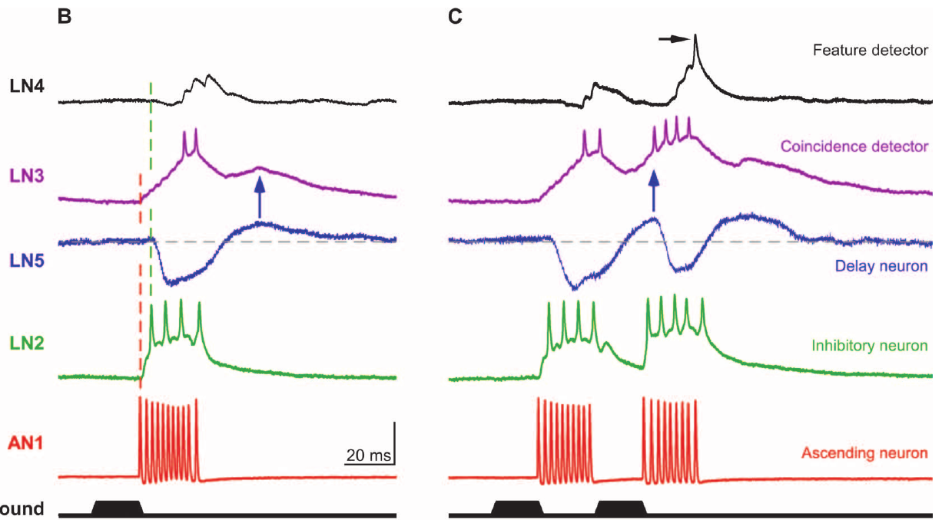
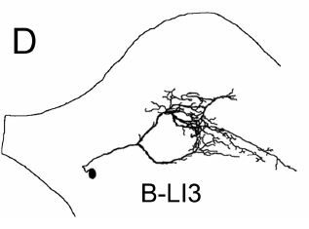
LN3 favors an intermediate interval between pulses
Schöneich and colleagues tested LN3 with pairs of 20-ms pulses separated by different silent intervals. A long interval allows the first delayed response to finish before the second direct response, whereas a very short interval merges or truncates the two responses.
At a 60-ms interval, LN3 generated similar responses to the two pulses. At 20 ms, its output increased from approximately 1.6 spikes to 3.2 spikes for the second pulse. The strongest enhancement occurred over intervals of about 15–25 ms.
This intermediate optimum is consistent with direct and delayed excitation summing during an appropriate temporal window. The cell also responds outside that window, so it is less selective than the final output neuron. The delayed component peaks approximately 43.5 ms after sound offset, and the timing of excitation arriving from the next pulse determines whether that component overlaps sufficiently with the direct pathway to enhance firing.
Schöneich et al. (2015), Fig. 5(B–C). Responses to one and two pulses.
Kostarakos & Hedwig (2012), Fig. 1(D). LN3 (200 μm common scale).
Schöneich et al. (2015); Kostarakos & Hedwig (2012)
32
Notes:
• Schöneich and colleagues tested LN3 with pairs of 20-ms pulses separated by different silent intervals. A long interval allows the first delayed response to finish before the second direct response, whereas a very short interval merges or truncates the two responses.
• At a 60-ms interval, LN3 generated similar responses to the two pulses. At 20 ms, its output increased from approximately 1.6 spikes to 3.2 spikes for the second pulse. The strongest enhancement occurred over intervals of about 15–25 ms.
• This intermediate optimum is consistent with direct and delayed excitation summing during an appropriate temporal window. The cell also responds outside that window, so it is less selective than the final output neuron. The delayed component peaks approximately 43.5 ms after sound offset, and the timing of excitation arriving from the next pulse determines whether that component overlaps sufficiently with the direct pathway to enhance firing.
• The delayed component peaks approximately 43.5 ms after sound offset. The timing of excitation arriving from the next pulse determines whether that component overlaps sufficiently with the direct pathway to enhance firing.
References:
Schöneich S, Kostarakos K, Hedwig B (2015). An auditory feature detection circuit for sound pattern recognition. Science Advances 1(8):e1500325. https://doi.org/10.1126/sciadv.1500325
Kostarakos K, Hedwig B (2012). Calling song recognition in female crickets: temporal tuning of identified brain neurons matches behavior. Journal of Neuroscience 32(28):9601–9612. https://doi.org/10.1523/JNEUROSCI.1170-12.2012
Figure: Schöneich et al. (2015), Fig. 5(B–C). Responses to one and two pulses.
Figure source: https://doi.org/10.1126/sciadv.1500325
Figure: Kostarakos & Hedwig (2012), Fig. 1(D). LN3 (200 μm common scale).
Figure source: https://doi.org/10.1523/JNEUROSCI.1170-12.2012

Slide 45
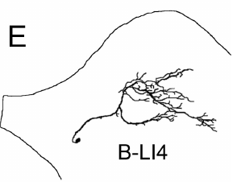
LN4 integrates excitation and inhibition
A feature detector responds preferentially to a stimulus property associated with a meaningful signal. LN4 combines the inhibitory branch attributed to LN2 with excitation following LN3’s coincidence-enhanced activity in the proposed song-recognition circuit.
A single 20-ms pulse usually produced inhibition followed by subthreshold depolarization in LN4. A second pulse after a 20-ms interval evoked approximately 1.4 spikes. Excitatory responses in LN4 followed LN3 spikes with a relatively constant delay near 3 ms.
The second-pulse excitation can overcome inhibition when the interval is appropriate, creating a more selective output than LN3 alone. LN4 is not the primary coincidence detector because it does not receive the delayed excitatory component directly. Subthreshold input changes the membrane voltage without eliciting a spike, so combining inhibition with strengthened excitation can sharpen selectivity even when the preceding neuron retains responses to less attractive patterns.
Schöneich et al. (2015), Fig. 5(B–C). Responses to one and two pulses.
Kostarakos & Hedwig (2012), Fig. 1(E). LN4 (200 μm common scale).
Schöneich et al. (2015); Kostarakos & Hedwig (2012)
33
Notes:
• A **feature detector** responds preferentially to a stimulus property associated with a meaningful signal. LN4 combines the inhibitory branch attributed to LN2 with excitation following LN3’s coincidence-enhanced activity in the proposed song-recognition circuit.
• A single 20-ms pulse usually produced inhibition followed by subthreshold depolarization in LN4. A second pulse after a 20-ms interval evoked approximately 1.4 spikes. Excitatory responses in LN4 followed LN3 spikes with a relatively constant delay near 3 ms.
• The second-pulse excitation can overcome inhibition when the interval is appropriate, creating a more selective output than LN3 alone. LN4 is not the primary coincidence detector because it does not receive the delayed excitatory component directly. Subthreshold input changes the membrane voltage without eliciting a spike, so combining inhibition with strengthened excitation can sharpen selectivity even when the preceding neuron retains responses to less attractive patterns.
• Subthreshold input changes the membrane voltage without eliciting a spike. Combining inhibition with strengthened excitation can sharpen selectivity even when the preceding neuron retains responses to less attractive patterns.
References:
Schöneich S, Kostarakos K, Hedwig B (2015). An auditory feature detection circuit for sound pattern recognition. Science Advances 1(8):e1500325. https://doi.org/10.1126/sciadv.1500325
Kostarakos K, Hedwig B (2012). Calling song recognition in female crickets: temporal tuning of identified brain neurons matches behavior. Journal of Neuroscience 32(28):9601–9612. https://doi.org/10.1523/JNEUROSCI.1170-12.2012
Figure: Schöneich et al. (2015), Fig. 5(B–C). Responses to one and two pulses.
Figure source: https://doi.org/10.1126/sciadv.1500325
Figure: Kostarakos & Hedwig (2012), Fig. 1(E). LN4 (200 μm common scale).
Figure source: https://doi.org/10.1523/JNEUROSCI.1170-12.2012

Slide 46
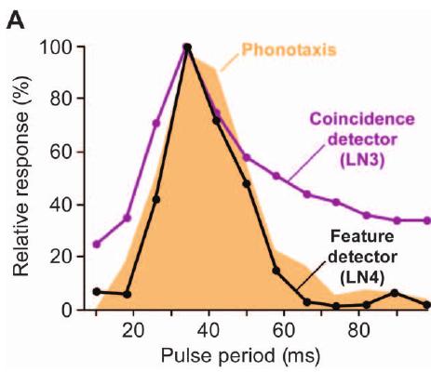
LN4 tuning matches phonotactic preference
Schöneich and colleagues compared neuronal pulse-period tuning with female phonotaxis using constant-sound-energy chirps. Band-pass selectivity favors intermediate periods and rejects both rapidly repeated and widely separated pulses rather than merely increasing with sound duration.
Across pulse periods of 10–98 ms, behavioral attraction peaked around 34 ms. LN3 and LN4 had similar optima, but the stronger filtering in LN4 more closely matched the behavioral response. The original figure plots these separately measured curves together.
The match links a physiological mechanism to the animal’s accepted timing range while avoiding a simple sound-energy explanation. Neural tuning and phonotaxis were measured independently, and a common optimum between LN4 and the behavior supports a recognition interpretation of the filtering in LN4.
Schöneich et al. (2015), Fig. 6(A). Neural and behavioral pulse-period tuning.
Schöneich et al. (2015), Fig. 5(A). Proposed auditory circuit.
Schöneich et al. (2015)
34
Notes:
• Schöneich and colleagues compared neuronal pulse-period tuning with female phonotaxis using constant-sound-energy chirps. **Band-pass selectivity** favors intermediate periods and rejects both rapidly repeated and widely separated pulses rather than merely increasing with sound duration.
• Across pulse periods of 10–98 ms, behavioral attraction peaked around 34 ms. LN3 and LN4 had similar optima, but the stronger filtering in LN4 more closely matched the behavioral response. The original figure plots these separately measured curves together.
• The match links a physiological mechanism to the animal’s accepted timing range while avoiding a simple sound-energy explanation. Neural tuning and phonotaxis were measured independently, and a common optimum between LN4 and the behavior supports a recognition interpretation of the filtering in LN4.
• Neural tuning and phonotaxis were measured independently. A common optimum strengthens a recognition interpretation but cannot, by itself, determine whether another unrecorded pathway contributes to the same preference.
References:
Schöneich S, Kostarakos K, Hedwig B (2015). An auditory feature detection circuit for sound pattern recognition. Science Advances 1(8):e1500325. https://doi.org/10.1126/sciadv.1500325
Figure: Schöneich et al. (2015), Fig. 6(A). Neural and behavioral pulse-period tuning.
Figure source: https://doi.org/10.1126/sciadv.1500325
Figure: Schöneich et al. (2015), Fig. 5(A). Proposed auditory circuit.
Figure source: https://doi.org/10.1126/sciadv.1500325

Slide 47
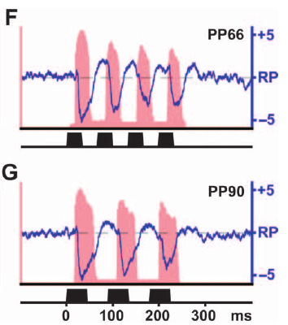
Slow pulses separate the two excitatory pathways
At slow pulse repetition, the delayed response to one event and the direct response to the next occur at different times. They therefore contribute less simultaneous excitation to LN3 even though AN1 can still report the individual sound pulses.
For pulse periods of 66–98 ms, Schöneich and colleagues found that AN1 spike activity and LN5 rebound depolarization drifted out of phase. These values corresponded to silent intervals of 33–49 ms in the tested constant-energy patterns.
Loss of overlap explains the circuit’s reduced response to slow patterns without requiring failure of auditory detection. It establishes the slow-period side of the band-pass mechanism. The published AN1 activity and LN5 membrane traces retain the source's time axes and voltage units, and the separation of their peaks is a physiological observation of the timing of the direct and delayed pathways.
Schöneich et al. (2015), Fig. 6(F–G). Slow pulses separate direct and delayed activity.
Schöneich et al. (2015), Fig. 5(A). Proposed auditory circuit.
Schöneich et al. (2015)
35
Notes:
• At slow pulse repetition, the delayed response to one event and the direct response to the next occur at different times. They therefore contribute less simultaneous excitation to LN3 even though AN1 can still report the individual sound pulses.
• For pulse periods of 66–98 ms, Schöneich and colleagues found that AN1 spike activity and LN5 rebound depolarization drifted out of phase. These values corresponded to silent intervals of 33–49 ms in the tested constant-energy patterns.
• Loss of overlap explains the circuit’s reduced response to slow patterns without requiring failure of auditory detection. It establishes the slow-period side of the band-pass mechanism. The published AN1 activity and LN5 membrane traces retain the source's time axes and voltage units, and the separation of their peaks is a physiological observation of the timing of the direct and delayed pathways.
• The published red AN1 activity and blue LN5 membrane traces retain the source’s time axes and voltage units. Separation of their peaks is a physiological observation, rather than a newly plotted theoretical curve.
References:
Schöneich S, Kostarakos K, Hedwig B (2015). An auditory feature detection circuit for sound pattern recognition. Science Advances 1(8):e1500325. https://doi.org/10.1126/sciadv.1500325
Figure: Schöneich et al. (2015), Fig. 6(F–G). Slow pulses separate direct and delayed activity.
Figure source: https://doi.org/10.1126/sciadv.1500325
Figure: Schöneich et al. (2015), Fig. 5(A). Proposed auditory circuit.
Figure source: https://doi.org/10.1126/sciadv.1500325

Slide 48
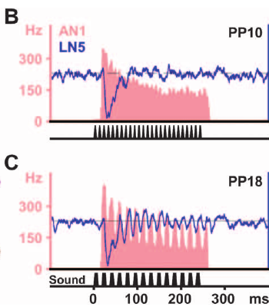
Fast pulses truncate rebound and weaken the input
Rapid repetition does not automatically create stronger coincidence. A new pulse can recruit inhibition before the previous LN5 rebound has developed, while adaptation reduces the fidelity and strength of the ascending acoustic response.
Schöneich and colleagues tested pulse periods below 34 ms, corresponding to intervals shorter than 17 ms. LN5 rebound was increasingly truncated by following inhibition, and AN1 adapted strongly enough to lose accurate copying of the fastest tested pulse patterns.
These effects weaken both the delayed and direct contributions to LN3 and establish the fast-period side of band-pass tuning. Adaptation is a decline in responsiveness during repeated stimulation, and adaptation together with renewed inhibition restricts responses to fast patterns, so recognition does not depend on a coincidence detector with an unrestricted fixed delay.
Schöneich et al. (2015), Fig. 6(B–C). Fast pulses truncate rebound.
Schöneich et al. (2015), Fig. 5(A). Proposed auditory circuit.
Schöneich et al. (2015)
36
Notes:
• Rapid repetition does not automatically create stronger coincidence. A new pulse can recruit inhibition before the previous LN5 rebound has developed, while adaptation reduces the fidelity and strength of the ascending acoustic response.
• Schöneich and colleagues tested pulse periods below 34 ms, corresponding to intervals shorter than 17 ms. LN5 rebound was increasingly truncated by following inhibition, and AN1 adapted strongly enough to lose accurate copying of the fastest tested pulse patterns.
• These effects weaken both the delayed and direct contributions to LN3 and establish the fast-period side of band-pass tuning. Adaptation is a decline in responsiveness during repeated stimulation, and adaptation together with renewed inhibition restricts responses to fast patterns, so recognition does not depend on a coincidence detector with an unrestricted fixed delay.
• Adaptation is a decline in responsiveness during repeated stimulation. In this circuit, adaptation and renewed inhibition jointly restrict fast-pattern responses, rather than making recognition depend on a coincidence detector with an unrestricted fixed delay.
References:
Schöneich S, Kostarakos K, Hedwig B (2015). An auditory feature detection circuit for sound pattern recognition. Science Advances 1(8):e1500325. https://doi.org/10.1126/sciadv.1500325
Figure: Schöneich et al. (2015), Fig. 6(B–C). Fast pulses truncate rebound.
Figure source: https://doi.org/10.1126/sciadv.1500325
Figure: Schöneich et al. (2015), Fig. 5(A). Proposed auditory circuit.
Figure source: https://doi.org/10.1126/sciadv.1500325

Slide 49
Band-pass tuning has a slow side and a fast side
A band-pass response weakens on both sides of its optimum, and in the cricket circuit two different processes set the two edges. At slow pulse repetition the direct and delayed pathways drift out of step, and at fast repetition inhibition and adaptation cut the signals down.
For pulse periods of 66–98 ms, the AN1 spike activity and the LN5 rebound depolarization drifted out of phase, which corresponds to silent intervals of 33–49 ms in the tested patterns. Less simultaneous excitation then reached LN3 even though AN1 still reported each individual pulse.
For pulse periods below 34 ms, which correspond to intervals shorter than 17 ms, a new pulse recruited inhibition before the previous LN5 rebound had developed. AN1 also adapted, and its copying of the fastest patterns deteriorated, which weakened both the delayed and the direct contributions to LN3.
Schöneich et al. (2015), Fig. 6(B–C). Fast pulses truncate rebound.
Schöneich et al. (2015), Fig. 5(A). Proposed auditory circuit.
Schöneich et al. (2015)
36a
Notes:
• A band-pass response needs one mechanism for the slow edge and another for the fast edge, and both were measured in the same circuit.
• The slow edge.
– At slow repetition the delayed response to one pulse and the direct response to the next occur at different times.
– Less simultaneous excitation reaches LN3, even though AN1 still reports the individual pulses.
• The fast edge.
– A new pulse can recruit inhibition before the previous LN5 rebound has developed.
– Adaptation, a decline in responsiveness during repeated stimulation, also weakens the ascending response.
• The numbers.
– Periods of 66–98 ms correspond to silent intervals of 33–49 ms in the constant-energy patterns.
– Periods below 34 ms correspond to intervals shorter than 17 ms.
• What this adds to the delay account.
– A pure delay line would respond to some faster repetitions, so the membrane and adaptation processes constrain that simpler account.
• Intervals used.
– The tested periods below 34 ms correspond to intervals shorter than 17 ms.
– LN5 rebound was increasingly truncated by the following inhibition as the repetition rate rose.
References:
Schöneich S, Kostarakos K, Hedwig B (2015). An auditory feature detection circuit for sound pattern recognition. Science Advances 1(8):e1500325. https://doi.org/10.1126/sciadv.1500325

Slide 50
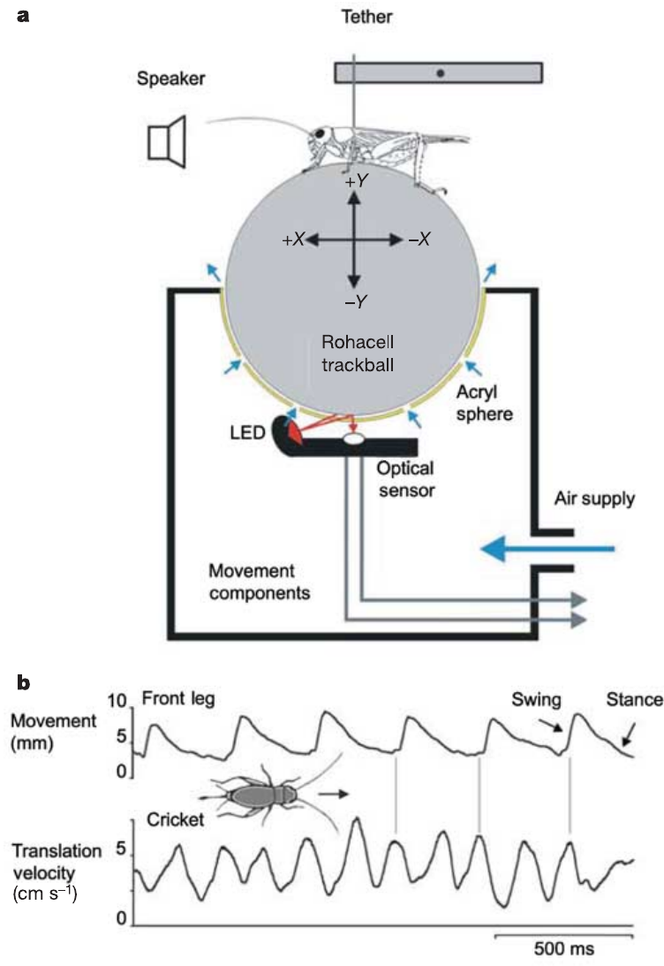
A fast trackball resolves pulse-linked steering
Hedwig and Poulet measured female Gryllus bimaculatus walking on a lightweight trackball floating in air. An optical sensor registered small ball movements, allowing lateral steering to be measured separately from forward walking rather than averaged over a whole chirp.
The system had a temporal resolution of 0.3 ms. During acoustic approach, females walked at approximately 5–7 cm/s, and their lateral velocity could change rapidly in response to individual pulses. Slow trackball measurements had previously averaged over much longer time windows.
The preparation reveals motor responses that a coarse measure can merge into an apparently smooth trajectory. High temporal resolution does not create a new recognition behavior; it changes which components of the existing behavior are observable. Forward and lateral velocity are distinct components of motion, so a cricket can continue walking forward while making alternating steering corrections that the trackball resolves separately.
Hedwig & Poulet (2004), Fig. 1(a–b). Cricket trackball and resolved stepping.
Hedwig & Poulet (2004)
37
Notes:
• Hedwig and Poulet measured female _Gryllus bimaculatus_ walking on a lightweight trackball floating in air. An optical sensor registered small ball movements, allowing lateral steering to be measured separately from forward walking rather than averaged over a whole chirp.
• The system had a temporal resolution of 0.3 ms. During acoustic approach, females walked at approximately 5–7 cm/s, and their lateral velocity could change rapidly in response to individual pulses. Slow trackball measurements had previously averaged over much longer time windows.
• The preparation reveals motor responses that a coarse measure can merge into an apparently smooth trajectory. High temporal resolution does not create a new recognition behavior; it changes which components of the existing behavior are observable. Forward and lateral velocity are distinct components of motion, so a cricket can continue walking forward while making alternating steering corrections that the trackball resolves separately.
• The published trackball illustration includes the animal and optical measurement arrangement. Forward and lateral velocity are distinct components of motion, so a cricket can continue walking forward while making alternating steering corrections.
References:
Hedwig B, Poulet JFA (2004). Complex auditory behaviour emerges from simple reactive steering. Nature 430(7001):781–785. https://doi.org/10.1038/nature02787
Figure: Hedwig & Poulet (2004), Fig. 1(a–b). Cricket trackball and resolved stepping.
Figure source: https://doi.org/10.1038/nature02787

Slide 51
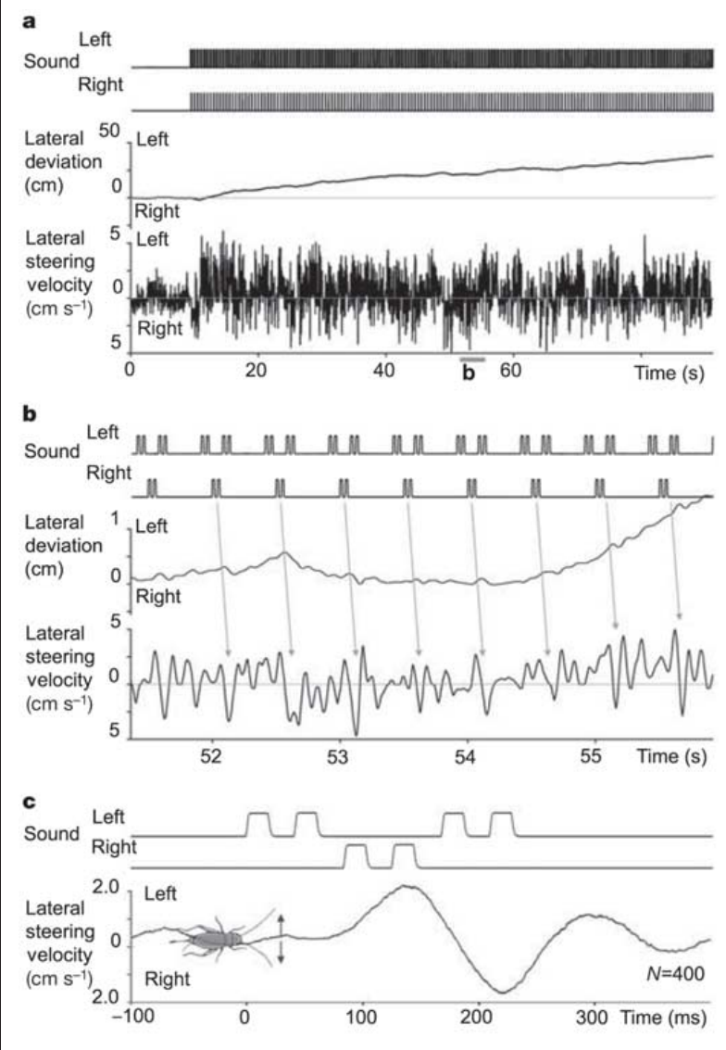
Split songs elicit rapid steering corrections
A split song distributes successive parts of one chirp across two speakers. Hedwig and Poulet presented six-pulse chirps in which pairs of consecutive pulses came from opposite sides, each speaker positioned 45° from the cricket’s forward axis.
Pulses lasted 21 ms and were separated by 21-ms intervals. Lateral steering followed the active side with a latency of approximately 55–60 ms and peak velocity near 5 cm/s. Each pulse pair produced a small lateral displacement of about 1 mm.
The animal’s overall path favored the side presenting more pulses, yet its individual corrections followed both sides. Net deviation therefore conceals alternating stimulus-linked responses. A cumulative path and an instantaneous velocity trace answer different questions: the cumulative path measures the integrated outcome, whereas the velocity trace exposes the sequence of corrections that contribute to it.
Hedwig & Poulet (2004), Fig. 2(a–c). Rapid steering toward split-song pulses.
Hedwig & Poulet (2004)
38
Notes:
• A **split song** distributes successive parts of one chirp across two speakers. Hedwig and Poulet presented six-pulse chirps in which pairs of consecutive pulses came from opposite sides, each speaker positioned 45° from the cricket’s forward axis.
• Pulses lasted 21 ms and were separated by 21-ms intervals. Lateral steering followed the active side with a latency of approximately 55–60 ms and peak velocity near 5 cm/s. Each pulse pair produced a small lateral displacement of about 1 mm.
• The animal’s overall path favored the side presenting more pulses, yet its individual corrections followed both sides. Net deviation therefore conceals alternating stimulus-linked responses. A cumulative path and an instantaneous velocity trace answer different questions: the cumulative path measures the integrated outcome, whereas the velocity trace exposes the sequence of corrections that contribute to it.
• A cumulative path and an instantaneous velocity trace answer different questions. The former measures the integrated outcome, whereas the latter exposes the sequence of corrections contributing to that outcome.
References:
Hedwig B, Poulet JFA (2004). Complex auditory behaviour emerges from simple reactive steering. Nature 430(7001):781–785. https://doi.org/10.1038/nature02787
Figure: Hedwig & Poulet (2004), Fig. 2(a–c). Rapid steering toward split-song pulses.
Figure source: https://doi.org/10.1038/nature02787

Slide 52
Split songs separate steering from recognition
A split song distributes successive parts of one chirp across two speakers, so each part pulls the cricket toward a different side. Hedwig and Poulet presented six-pulse chirps in which pairs of consecutive pulses came from opposite sides, with each speaker 45° from the cricket's forward axis.
Lateral steering followed the active side with a latency of approximately 55–60 ms and a peak velocity near 5 cm/s, and each pulse pair produced a displacement of about 1 mm. The path as a whole favored the side that presented more pulses, while the individual corrections followed both sides.
Net deviation therefore conceals a series of alternating, stimulus-linked responses. Recognition of an attractive rhythm and rapid localization of its pulses are separable processes, since a weakly attractive 147-ms pattern could still draw corrections when the attractive 21-ms pattern played from the opposite side.
Hedwig & Poulet (2004), Fig. 2(a–c). Rapid steering toward split-song pulses.
Hedwig & Poulet (2004)
38a
Notes:
• A high-resolution measure of steering separates the fast corrections to single pulses from the slower, overall path.
• The split-song design.
– Pairs of consecutive pulses within a six-pulse chirp came from opposite speakers, each placed 45° from the forward axis.
– Pulses lasted 21 ms with 21-ms intervals.
• Fast corrections.
– Steering followed the active side with a latency of approximately 55–60 ms.
– Each pulse pair produced a lateral displacement of about 1 mm.
• Path versus velocity.
– A cumulative path measures the integrated outcome, whereas an instantaneous velocity trace exposes the sequence of corrections that produce it.
– The overall path favored the side with more pulses, but the corrections alternated.
• Two processes.
– The 147-ms pattern alone produced about 14% of the reference response, and the strongly attractive 21-ms pattern fell to about 24% when the competing pattern was also present.
– Recognition and rapid localization therefore interact, and the experiment separates them.
• Measuring steering.
– A lightweight trackball floating in air allows lateral steering to be measured separately from forward walking.
– The optical sensor has a temporal resolution of 0.3 ms, which resolves responses to single pulses.
References:
Hedwig B, Poulet JFA (2004). Complex auditory behaviour emerges from simple reactive steering. Nature 430(7001):781–785. https://doi.org/10.1038/nature02787

Slide 53
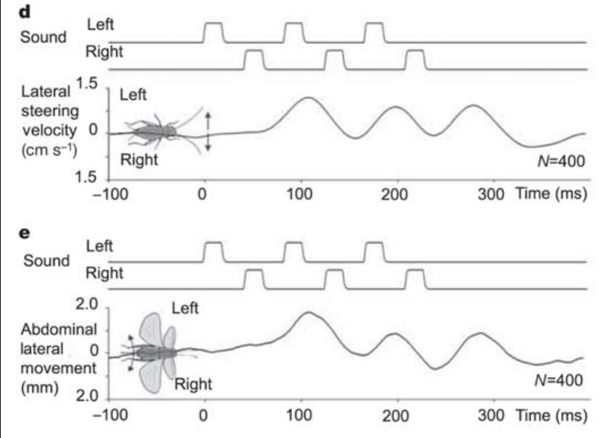
Walking and flight retain pulse-linked steering
Auditory orientation can be expressed through different motor systems. During walking, cricket leg movements produce lateral trajectory changes; during tethered flight, abdominal movement serves as a measurable steering response toward a sound source.
Hedwig and Poulet tested the same females with consecutive pulses alternating between speakers. A constant wind stream elicited flight, and an optical recording system measured abdominal displacement. Flight steering followed the alternating sound pulses with a temporal pattern comparable to walking steering.
The correspondence supports rapid acoustic steering across locomotor modes rather than a response unique to one trackball mechanism. The measured flight variable is abdominal steering, and comparing its time course with trackball lateral velocity supports a common rapid sensory influence that reaches different state-dependent motor pathways.
Hedwig & Poulet (2004), Fig. 2(d–e). Pulse-linked steering during walking and flight.
Hedwig & Poulet (2004)
39
Notes:
• Auditory orientation can be expressed through different motor systems. During walking, cricket leg movements produce lateral trajectory changes; during tethered flight, abdominal movement serves as a measurable steering response toward a sound source.
• Hedwig and Poulet tested the same females with consecutive pulses alternating between speakers. A constant wind stream elicited flight, and an optical recording system measured abdominal displacement. Flight steering followed the alternating sound pulses with a temporal pattern comparable to walking steering.
• The correspondence supports rapid acoustic steering across locomotor modes rather than a response unique to one trackball mechanism. The measured flight variable is abdominal steering, and comparing its time course with trackball lateral velocity supports a common rapid sensory influence that reaches different state-dependent motor pathways.
• The measured flight variable is abdominal steering, not an actual airborne trajectory. Comparing its time course with trackball lateral velocity supports a common rapid sensory influence while retaining the distinction between the motor measurements.
References:
Hedwig B, Poulet JFA (2004). Complex auditory behaviour emerges from simple reactive steering. Nature 430(7001):781–785. https://doi.org/10.1038/nature02787
Figure: Hedwig & Poulet (2004), Fig. 2(d–e). Pulse-linked steering during walking and flight.
Figure source: https://doi.org/10.1038/nature02787

Slide 54
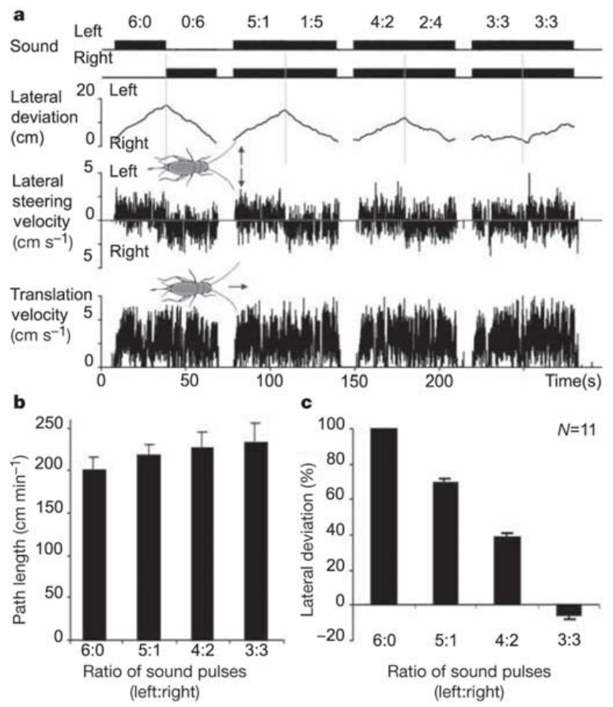
Pulse ratios predict net lateral deviation
When a chirp is divided between competing directions, net steering can accumulate from corrections toward individual pulses. Hedwig and Poulet varied how many of six pulses arrived from each side rather than changing the total number presented.
Females generally deviated toward the speaker providing the larger share, across ratios including 5:1, 4:2 and 3:3. At equal pulse numbers, opposing steering contributions reduced net lateral deviation even though acoustic stimulation and forward walking continued.
The result supports accumulation of rapid directional responses as an explanation for overall orientation under these split-song conditions. The measured path emerges from unequal motor corrections toward individual pulses, without an explicit complete-chirp choice preceding every movement, and keeping six pulses controls total pulse number while changing their spatial assignment.
Hedwig & Poulet (2004), Fig. 3(a–c). Pulse ratios predict net lateral deviation.
Hedwig & Poulet (2004)
40
Notes:
• When a chirp is divided between competing directions, net steering can accumulate from corrections toward individual pulses. Hedwig and Poulet varied how many of six pulses arrived from each side rather than changing the total number presented.
• Females generally deviated toward the speaker providing the larger share, across ratios including 5:1, 4:2 and 3:3. At equal pulse numbers, opposing steering contributions reduced net lateral deviation even though acoustic stimulation and forward walking continued.
• The result supports accumulation of rapid directional responses as an explanation for overall orientation under these split-song conditions. The measured path emerges from unequal motor corrections toward individual pulses, without an explicit complete-chirp choice preceding every movement, and keeping six pulses controls total pulse number while changing their spatial assignment.
• Maintaining six pulses controls total pulse number while changing their spatial assignment. Randomizing which pulses came from each side reduces the likelihood that one fixed position in the chirp alone explains the net direction.
References:
Hedwig B, Poulet JFA (2004). Complex auditory behaviour emerges from simple reactive steering. Nature 430(7001):781–785. https://doi.org/10.1038/nature02787
Figure: Hedwig & Poulet (2004), Fig. 3(a–c). Pulse ratios predict net lateral deviation.
Figure source: https://doi.org/10.1038/nature02787

Slide 55
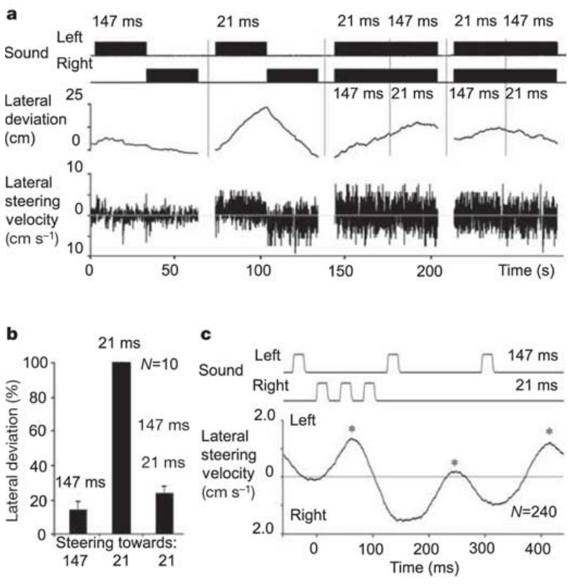
Recognition modulates reactive steering
Recognition of an attractive rhythm and rapid localization of its pulses are separable processes. Hedwig and Poulet compared three-pulse patterns with 21-ms or 147-ms intervals and also presented the two patterns simultaneously from opposite sides.
The 147-ms pattern alone produced approximately 14% of the reference steering response. The 21-ms pattern was strongly attractive alone, but its net response fell to about 24% when the competing pattern was also present; the animal made corrections toward pulses from both directions.
A weakly attractive temporal pattern can therefore influence immediate steering during concurrent attractive stimulation. The authors proposed modulation of a rapid reactive pathway over a longer time course. The experiment distinguishes attractiveness when a pattern is presented alone from its ability to redirect movement during concurrent song, so context changes how recognition and directional motor responses combine.
Hedwig & Poulet (2004), Fig. 4(a–c). Competing temporal patterns redirect steering.
Hedwig & Poulet (2004)
41
Notes:
• Recognition of an attractive rhythm and rapid localization of its pulses are separable processes. Hedwig and Poulet compared three-pulse patterns with 21-ms or 147-ms intervals and also presented the two patterns simultaneously from opposite sides.
• The 147-ms pattern alone produced approximately 14% of the reference steering response. The 21-ms pattern was strongly attractive alone, but its net response fell to about 24% when the competing pattern was also present; the animal made corrections toward pulses from both directions.
• A weakly attractive temporal pattern can therefore influence immediate steering during concurrent attractive stimulation. The authors proposed modulation of a rapid reactive pathway over a longer time course. The experiment distinguishes attractiveness when a pattern is presented alone from its ability to redirect movement during concurrent song, so context changes how recognition and directional motor responses combine.
• The experiment distinguishes attractiveness when a pattern is presented alone from its ability to redirect movement during concurrent song. Context changes how recognition and directional motor responses combine, without proving that the cricket confuses the two rhythms.
References:
Hedwig B, Poulet JFA (2004). Complex auditory behaviour emerges from simple reactive steering. Nature 430(7001):781–785. https://doi.org/10.1038/nature02787
Figure: Hedwig & Poulet (2004), Fig. 4(a–c). Competing temporal patterns redirect steering.
Figure source: https://doi.org/10.1038/nature02787

Slide 56
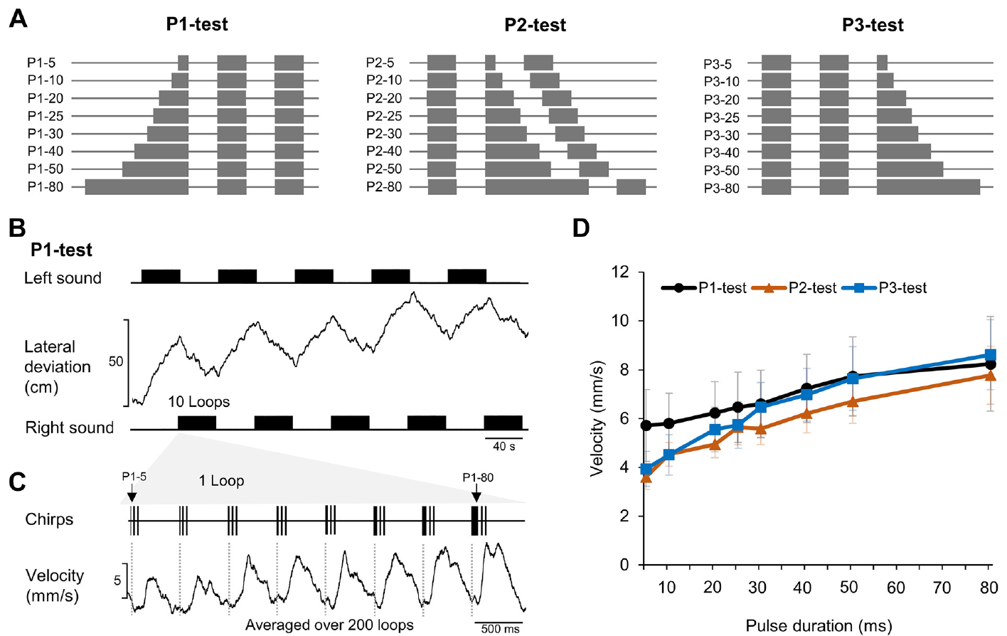
Duration tests challenge the canonical circuit
Zhang and Hedwig varied one pulse within a three-pulse chirp while recording phonotaxis and identified brain neurons in female Gryllus bimaculatus. This tests timing sensitivity beyond simply changing every pulse and pause together.
The selected first, second or third pulse ranged from 5 to 80 ms. Other pulses and silent intervals remained 20 ms; chirps repeated every 500 ms with a 4.8-kHz carrier. Alternating left and right presentation reduced persistent directional bias.
Phonotactic steering increased with longer test pulses more broadly than expected from the selective output of the canonical recognition circuit. Because these test patterns were embedded in loops containing attractive chirps, the behavior concerns that stimulation context. Keeping two pulses normal preserves attractive temporal elements within the stimulus sequence, so the test examines processing under a mixed temporal context instead of repeating a uniform pulse-period tuning experiment.
Zhang & Hedwig (2023), Fig. 1(A–D). Pulse-duration tests and phonotactic responses.
Zhang & Hedwig (2023)
42
Notes:
• Zhang and Hedwig varied one pulse within a three-pulse chirp while recording phonotaxis and identified brain neurons in female _Gryllus bimaculatus_. This tests timing sensitivity beyond simply changing every pulse and pause together.
• The selected first, second or third pulse ranged from 5 to 80 ms. Other pulses and silent intervals remained 20 ms; chirps repeated every 500 ms with a 4.8-kHz carrier. Alternating left and right presentation reduced persistent directional bias.
• Phonotactic steering increased with longer test pulses more broadly than expected from the selective output of the canonical recognition circuit. Because these test patterns were embedded in loops containing attractive chirps, the behavior concerns that stimulation context. Keeping two pulses normal preserves attractive temporal elements within the stimulus sequence, so the test examines processing under a mixed temporal context instead of repeating a uniform pulse-period tuning experiment.
• Keeping two pulses normal preserves attractive temporal elements within the stimulus sequence. The new test therefore interrogates processing under a mixed temporal context rather than simply repeating a uniform pulse-period tuning experiment.
References:
Zhang X, Hedwig B (2023). Sound processing in the cricket brain: evidence for a pulse duration filter. Journal of Neurophysiology 130:953–966. https://doi.org/10.1152/jn.00252.2023
Figure: Zhang & Hedwig (2023), Fig. 1(A–D). Pulse-duration tests and phonotactic responses.
Figure source: https://doi.org/10.1152/jn.00252.2023

Slide 57
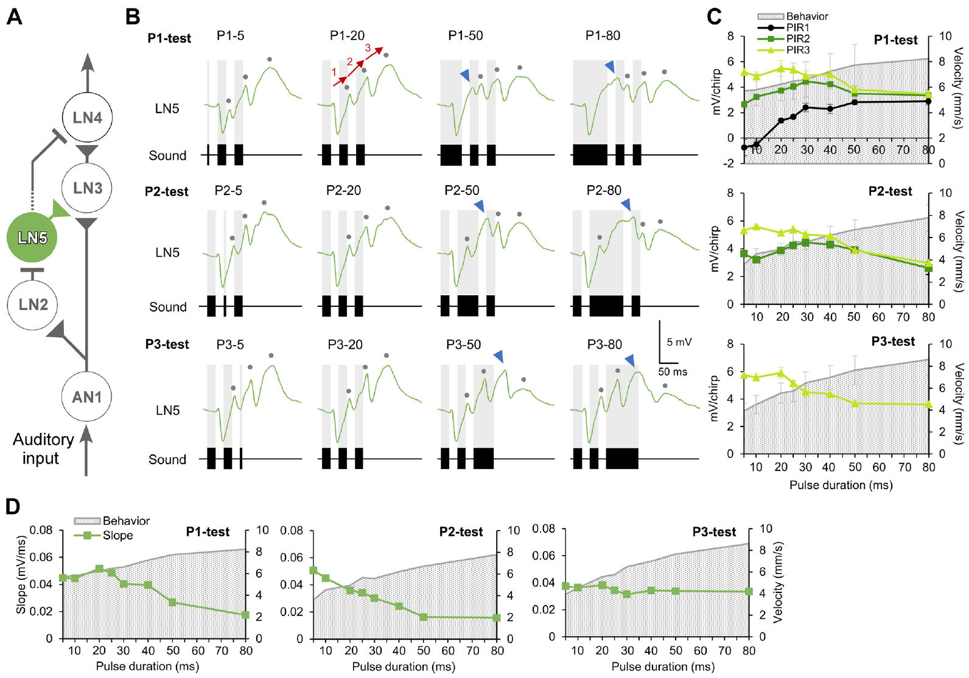
LN5 rebound depends on duration and position
Zhang and Hedwig recorded LN5 during the three pulse-position tests. The cell remained nonspiking and exhibited alternating inhibitory responses and rebound depolarizations, but the individual rebounds were not interchangeable across positions in the chirp.
Extending the first pulse from 5 toward 80 ms increased its subsequent rebound, and pulses longer than about 30 ms could produce an additional deflection before the main rebound. Comparable extensions at other pulse positions did not yield identical changes.
These responses complicate a simple fixed-delay account in which every pulse generates the same delayed signal. Intrinsic and network-dependent membrane dynamics interact with preceding sound history. Pulse position controls which previous inhibitory and excitatory states the tested event encounters, and the recordings retain separate first, second and third rebound labels.
Zhang & Hedwig (2023), Fig. 3(A–D). LN5 rebound during varied pulse durations.
Zhang & Hedwig (2023)
43
Notes:
• Zhang and Hedwig recorded LN5 during the three pulse-position tests. The cell remained nonspiking and exhibited alternating inhibitory responses and rebound depolarizations, but the individual rebounds were not interchangeable across positions in the chirp.
• Extending the first pulse from 5 toward 80 ms increased its subsequent rebound, and pulses longer than about 30 ms could produce an additional deflection before the main rebound. Comparable extensions at other pulse positions did not yield identical changes.
• These responses complicate a simple fixed-delay account in which every pulse generates the same delayed signal. Intrinsic and network-dependent membrane dynamics interact with preceding sound history. Pulse position controls which previous inhibitory and excitatory states the tested event encounters, and the recordings retain separate first, second and third rebound labels.
• The original diagram identifies LN5 within the proposed circuit, and the recordings retain separate first, second and third rebound labels. Pulse position controls which previous inhibitory and excitatory states the tested event encounters.
References:
Zhang X, Hedwig B (2023). Sound processing in the cricket brain: evidence for a pulse duration filter. Journal of Neurophysiology 130:953–966. https://doi.org/10.1152/jn.00252.2023
Figure: Zhang & Hedwig (2023), Fig. 3(A–D). LN5 rebound during varied pulse durations.
Figure source: https://doi.org/10.1152/jn.00252.2023

Slide 58
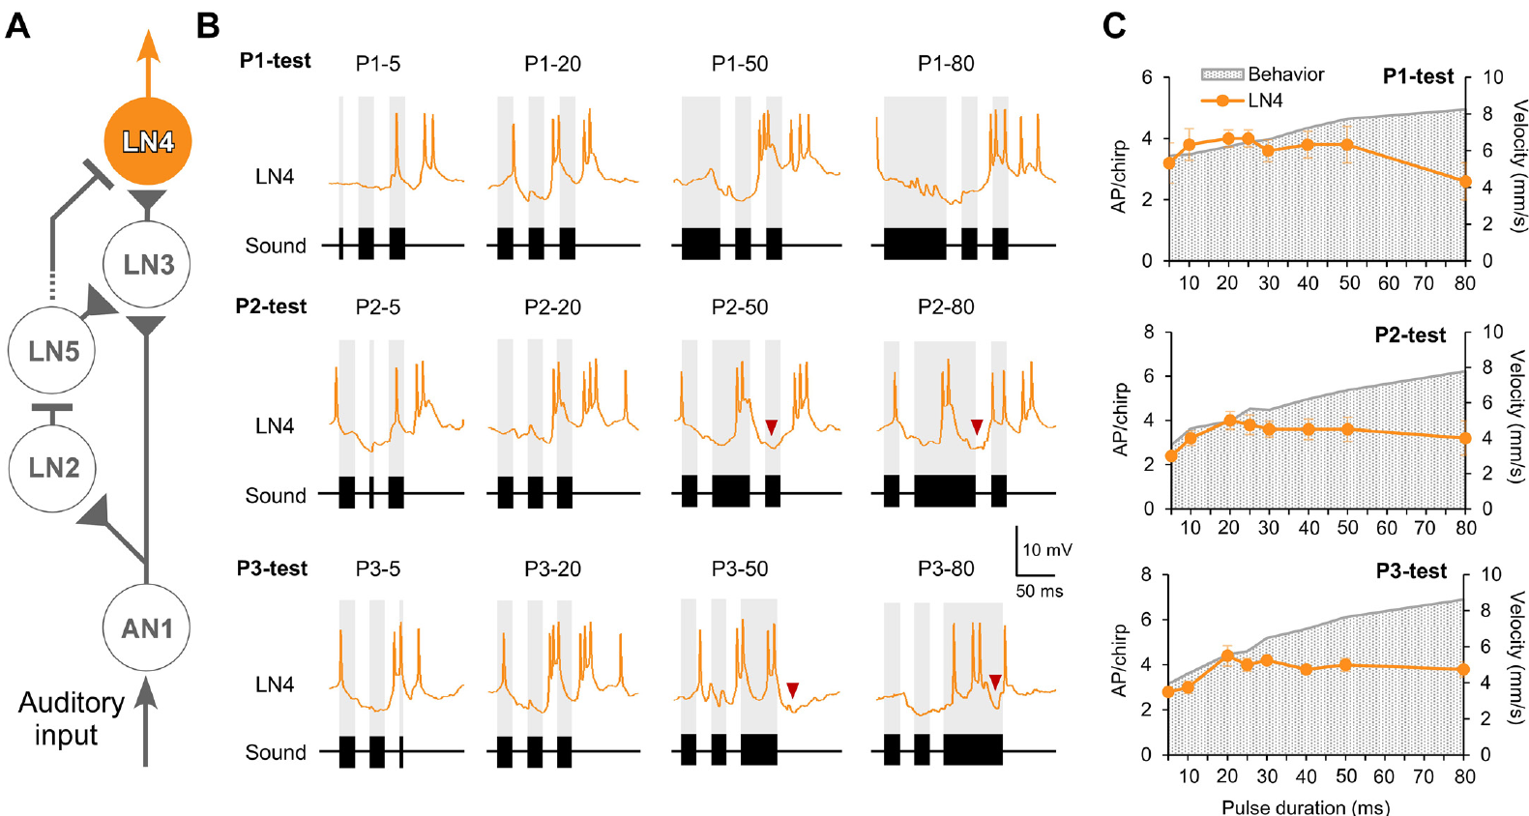
Long pulses recruit late inhibition in LN4
The feature-detector neuron LN4 receives excitation and inhibition rather than merely reproducing sound duration. Zhang and Hedwig examined its responses when a single pulse within a chirp was lengthened while neighboring pulse and interval values remained normal.
A long second pulse of 50 or 80 ms elicited an early excitatory burst followed by inhibition. The associated depolarization was restricted to approximately 34 ms, shorter than the ongoing sound. Long third pulses likewise produced brief excitation terminated by inhibition.
This truncation supports a duration-limiting process within neural recognition output, even when behavior remains broadly responsive. The authors distinguish the late inhibitory component from the initial sound-evoked inhibition, and the response indicates that more sound does not produce proportionally more LN4 spikes.
Zhang & Hedwig (2023), Fig. 6(A–C). LN4 activity and pulse-duration tuning.
Zhang & Hedwig (2023)
44
Notes:
• The feature-detector neuron LN4 receives excitation and inhibition rather than merely reproducing sound duration. Zhang and Hedwig examined its responses when a single pulse within a chirp was lengthened while neighboring pulse and interval values remained normal.
• A long second pulse of 50 or 80 ms elicited an early excitatory burst followed by inhibition. The associated depolarization was restricted to approximately 34 ms, shorter than the ongoing sound. Long third pulses likewise produced brief excitation terminated by inhibition.
• This truncation supports a duration-limiting process within neural recognition output, even when behavior remains broadly responsive. The authors distinguish the late inhibitory component from the initial sound-evoked inhibition, and the response indicates that more sound does not produce proportionally more LN4 spikes.
• The yellow LN4 traces and circuit labels are original published colors. The authors distinguish the late inhibitory component from the initial sound-evoked inhibition, leaving its exact pathway unresolved rather than assigning it to an identified new neuron.
References:
Zhang X, Hedwig B (2023). Sound processing in the cricket brain: evidence for a pulse duration filter. Journal of Neurophysiology 130:953–966. https://doi.org/10.1152/jn.00252.2023
Figure: Zhang & Hedwig (2023), Fig. 6(A–C). LN4 activity and pulse-duration tuning.
Figure source: https://doi.org/10.1152/jn.00252.2023

Slide 59
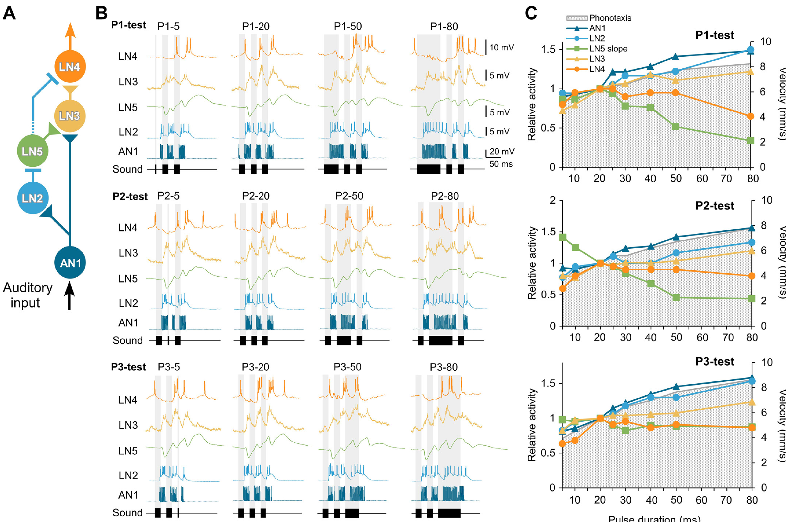
The circuit does not explain every steering response
Zhang and Hedwig compared AN1 and LN2–LN5 with the phonotactic responses to the same pulse-position paradigms. The early pathway tended to increase activity with longer pulses, whereas the final selective output did not match all behavioral changes.
Across 5–80-ms test pulses, AN1 and LN2 output broadly rose with duration, while LN4 responses could decline or remain comparatively restricted. Long pulses also produced additional activity in LN3 and modified LN5 rebound, exposing computations absent from a single uniform pulse-period description.
The five-neuron circuit provides strong physiological evidence for interval recognition but is insufficient as a complete account of context-dependent steering. Additional processing, duration filtering and modulation remain plausible contributions. Evidence for an interval-recognition mechanism and evidence for its limits can coexist: a mismatch between output tuning and behavior constrains the completeness of the circuit, and the rebound and coincidence phenomena recorded in the earlier study stand.
Zhang & Hedwig (2023), Fig. 8(A–C). Circuit responses diverge from behavioral tuning.
Zhang & Hedwig (2023)
45
Notes:
• Zhang and Hedwig compared AN1 and LN2–LN5 with the phonotactic responses to the same pulse-position paradigms. The early pathway tended to increase activity with longer pulses, whereas the final selective output did not match all behavioral changes.
• Across 5–80-ms test pulses, AN1 and LN2 output broadly rose with duration, while LN4 responses could decline or remain comparatively restricted. Long pulses also produced additional activity in LN3 and modified LN5 rebound, exposing computations absent from a single uniform pulse-period description.
• The five-neuron circuit provides strong physiological evidence for interval recognition but is insufficient as a complete account of context-dependent steering. Additional processing, duration filtering and modulation remain plausible contributions. Evidence for an interval-recognition mechanism and evidence for its limits can coexist: a mismatch between output tuning and behavior constrains the completeness of the circuit, and the rebound and coincidence phenomena recorded in the earlier study stand.
• Evidence for an interval-recognition mechanism and evidence for its limits can coexist. A mismatch between output tuning and behavior constrains completeness, not the existence of the rebound and coincidence phenomena directly recorded in the earlier study.
References:
Zhang X, Hedwig B (2023). Sound processing in the cricket brain: evidence for a pulse duration filter. Journal of Neurophysiology 130:953–966. https://doi.org/10.1152/jn.00252.2023
Figure: Zhang & Hedwig (2023), Fig. 8(A–C). Circuit responses diverge from behavioral tuning.
Figure source: https://doi.org/10.1152/jn.00252.2023

Slide 60
Key takeaways
Inherited matching. Species and hybrid song preferences support inherited sender–receiver matching, but do not identify a shared gene or channel.
Directional acoustics. Foreleg tympana combine external sound with tracheal inputs; contralateral-spiracle phase strongly contributes to forward directionality.
Input and selectivity. Thoracic and ascending cells can copy pulses without recognizing their rhythm; local brain processing creates more selective output.
Rebound and coincidence. LN5 generates intrinsic offset-linked rebound; delayed excitation combines with AN1 input in LN3, and LN4 integrates enhanced excitation with inhibition.
Recognition and steering. Selective recognition and fast directional corrections are distinct interacting processes; net phonotaxis can accumulate from steering toward individual pulses.
Evidence and limits. Proposed connections and molecular mechanisms require their own causal tests, and the five-neuron circuit does not explain all context-dependent pulse-duration responses.
Hoy & Paul (1973); Michelsen et al. (1994); Hedwig & Poulet (2004); Schöneich et al. (2015); Zhang & Hedwig (2023)
46
Notes:
Teaching transcript:
• Inherited matching. Species and hybrid song preferences support inherited sender–receiver matching, but do not identify a shared gene or channel.
• Directional acoustics. Foreleg tympana combine external sound with tracheal inputs; contralateral-spiracle phase strongly contributes to forward directionality.
• Input and selectivity. Thoracic and ascending cells can copy pulses without recognizing their rhythm; local brain processing creates more selective output.
• Rebound and coincidence. LN5 generates intrinsic offset-linked rebound; delayed excitation combines with AN1 input in LN3, and LN4 integrates enhanced excitation with inhibition.
• Recognition and steering. Selective recognition and fast directional corrections are distinct interacting processes; net phonotaxis can accumulate from steering toward individual pulses.
• Evidence and limits. Proposed connections and molecular mechanisms require their own causal tests, and the five-neuron circuit does not explain all context-dependent pulse-duration responses.
References:
Hoy RR, Paul RC (1973). Genetic control of song specificity in crickets. Science 180(4081):82–83. https://doi.org/10.1126/science.180.4081.82
Pollack GS, Hoy RR (1979). Temporal pattern as a cue for species-specific calling song recognition in crickets. Science 204(4391):429–432. https://doi.org/10.1126/science.204.4391.429
Michelsen A, Popov AV, Lewis B (1994). Physics of directional hearing in the cricket Gryllus bimaculatus. Journal of Comparative Physiology A 175:153–164. https://doi.org/10.1007/BF00215111
Wohlers DW, Huber F (1982). Processing of sound signals by six types of neurons in the prothoracic ganglion of the cricket, Gryllus campestris L. Journal of Comparative Physiology A 146:161–173. https://doi.org/10.1007/BF00610234
Selverston AI, Kleindienst HU, Huber F (1985). Synaptic connectivity between cricket auditory interneurons as studied by selective photoinactivation. Journal of Neuroscience 5(5):1283–1292. https://doi.org/10.1523/JNEUROSCI.05-05-01283.1985
Kostarakos K, Hedwig B (2012). Calling song recognition in female crickets: temporal tuning of identified brain neurons matches behavior. Journal of Neuroscience 32(28):9601–9612. https://doi.org/10.1523/JNEUROSCI.1170-12.2012
Schöneich S, Kostarakos K, Hedwig B (2015). An auditory feature detection circuit for sound pattern recognition. Science Advances 1(8):e1500325. https://doi.org/10.1126/sciadv.1500325
Hedwig B, Poulet JFA (2004). Complex auditory behaviour emerges from simple reactive steering. Nature 430(7001):781–785. https://doi.org/10.1038/nature02787
Zhang X, Hedwig B (2023). Sound processing in the cricket brain: evidence for a pulse duration filter. Journal of Neurophysiology 130:953–966. https://doi.org/10.1152/jn.00252.2023

