Slide 1

NEUR 411 · NEUROETHOLOGY · FALL 2026
Lecture 21
Electroreception II:
active electrolocation in weakly electric fish (Bullock)
Wednesday, October 14, 2026
Jordan Lopez, Ph.D.
Professor of Neurobiology & Biomedical Engineering
Photo: Elephantnose fish (Gnathonemus petersii). Jutta234, CC BY-SA 3.0.
Notes:
Electroreception II: active electrolocation in weakly electric fish (Bullock)
Lecture 21. NEUR 411 · NEUROETHOLOGY · FALL 2026. Wednesday, October 14, 2026.
Image: Photo: Elephantnose fish (Gnathonemus petersii). Jutta234, CC BY-SA 3.0. Credit: Jutta234 / Wikimedia Commons. License: CC BY-SA 3.0. Source: https://commons.wikimedia.org/wiki/File:Gnathonemus_petersii_-_Zoo_Frankfurt.jpg

Slide 2
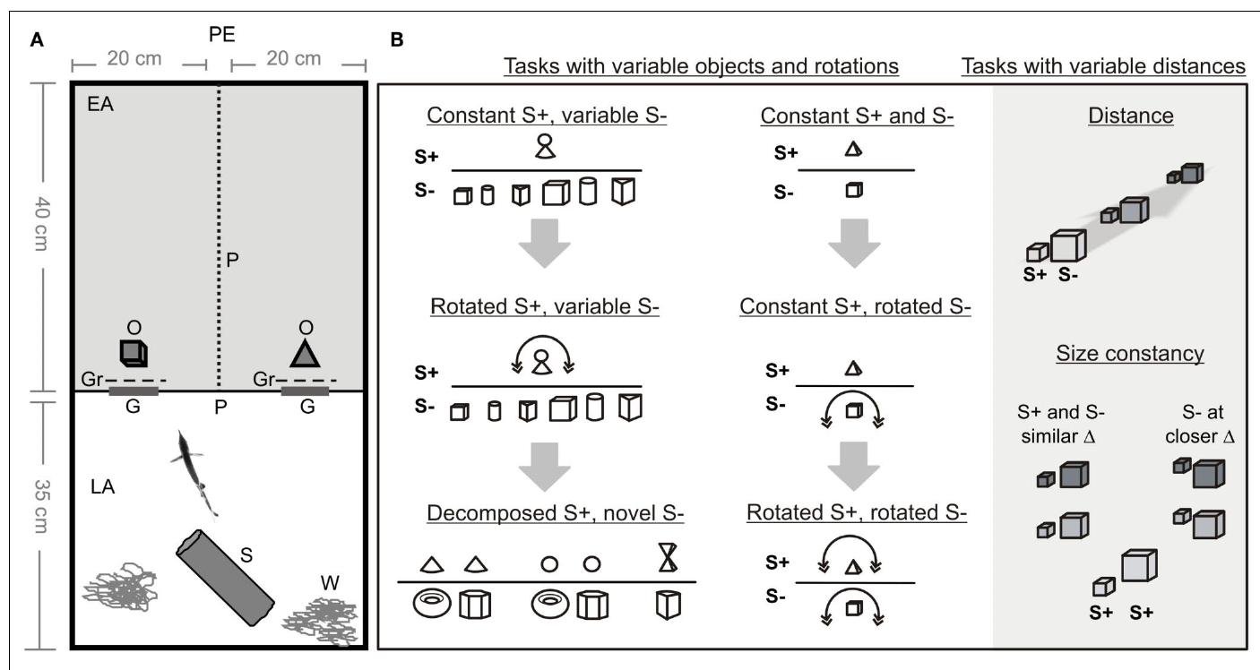
Self-generated electric fields support object recognition
Active electrolocation is detection of nearby objects through changes in an electric field generated by the animal. The weakly electric elephantnose fish, Gnathonemus petersii, emits brief electric organ discharges, or EODs, and senses how surrounding objects alter the resulting current at its skin.
Von der Emde and colleagues trained fish to choose between three-dimensional objects using a two-alternative task. Recognition persisted in complete darkness, including tests of size and rotation, establishing that visible appearance was unnecessary under these conditions.
The behavior concerns near-field sensing rather than a long-range image of the environment. Object recognition failed beyond approximately 4 cm in the tested tasks, even though physical electric fields extend farther.
von der Emde et al. (2010), Fig. 1(A–B). Object-choice apparatus and experimental manipulations.
von der Emde et al. (2010)
02
Notes:
• Active electrolocation is detection of nearby objects through changes in an electric field generated by the animal. The weakly electric elephantnose fish, Gnathonemus petersii, emits brief electric organ discharges, or EODs, and senses how surrounding objects alter the resulting current at its skin.
• Von der Emde and colleagues trained fish to choose between three-dimensional objects using a two-alternative task. Recognition persisted in complete darkness, including tests of size and rotation, establishing that visible appearance was unnecessary under these conditions.
• The behavior concerns near-field sensing rather than a long-range image of the environment. Object recognition failed beyond approximately 4 cm in the tested tasks, even though physical electric fields extend farther.
• A two-alternative choice measures which of two objects the animal selects. Accurate choice in darkness establishes a nonvisual capacity under the controlled task conditions.
References:
G. von der Emde; K. Behr; B. Bouton; J. Engelmann; S. Fetz; C. Folde (2010). 3-Dimensional scene perception during active electrolocation in a weakly electric pulse fish. Frontiers in Behavioral Neuroscience 4:26. https://doi.org/10.3389/fnbeh.2010.00026
Figure: von der Emde et al. (2010), Fig. 1(A–B). Object-choice apparatus and experimental manipulations.
Figure source: https://doi.org/10.3389/fnbeh.2010.00026

Slide 3
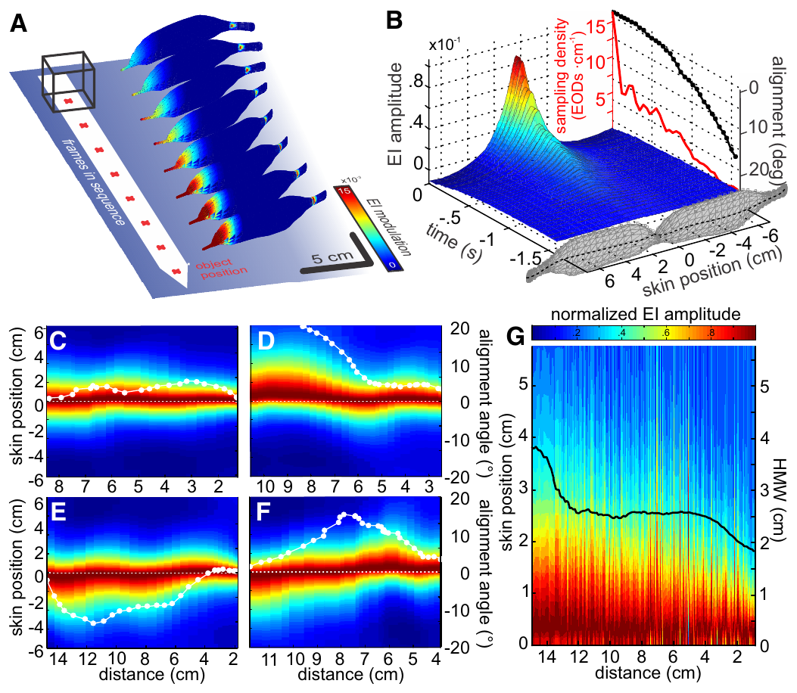
An electric image is a pattern across the sensory skin
An electric image is the spatial pattern of object-induced change in current across the fish’s skin. An object whose conductivity differs from the surrounding water changes the local electric field; the pattern therefore depends on both the object and the fish’s position.
Hofmann and colleagues recorded spontaneous approaches to metal cubes and reconstructed electric images with a biophysical model. Their comparison of object-present and object-absent conditions isolated the perturbation attributable to the object along the sensory surface.
The reconstructed images changed over successive discharges during approach. These are model-based estimates constrained by measured behavior, rather than direct recordings from every receptor, and they do not establish a one-to-one copy of object geometry.
Hofmann et al. (2017), Fig. 2(A–G). Published reconstruction of electric images during approach.
Hofmann et al. (2017)
03
Notes:
• An electric image is the spatial pattern of object-induced change in current across the fish’s skin. An object whose conductivity differs from the surrounding water changes the local electric field; the pattern therefore depends on both the object and the fish’s position.
• Hofmann and colleagues recorded spontaneous approaches to metal cubes and reconstructed electric images with a biophysical model. Their comparison of object-present and object-absent conditions isolated the perturbation attributable to the object along the sensory surface.
• The reconstructed images changed over successive discharges during approach. These are model-based estimates constrained by measured behavior, rather than direct recordings from every receptor, and they do not establish a one-to-one copy of object geometry.
• Conductivity describes how readily a material carries electric current. The reconstruction compared otherwise matched simulated scenes with and without the object.
References:
V. Hofmann; J.I. Sanguinetti-Scheck; L. Gómez-Sena; J. Engelmann (2017). Sensory Flow as a Basis for a Novel Distance Cue in Freely Behaving Electric Fish. Journal of Neuroscience 37(2):302–312. https://doi.org/10.1523/JNEUROSCI.1361-16.2016
Figure: Hofmann et al. (2017), Fig. 2(A–G). Published reconstruction of electric images during approach.
Figure source: https://doi.org/10.1523/JNEUROSCI.1361-16.2016

Slide 4
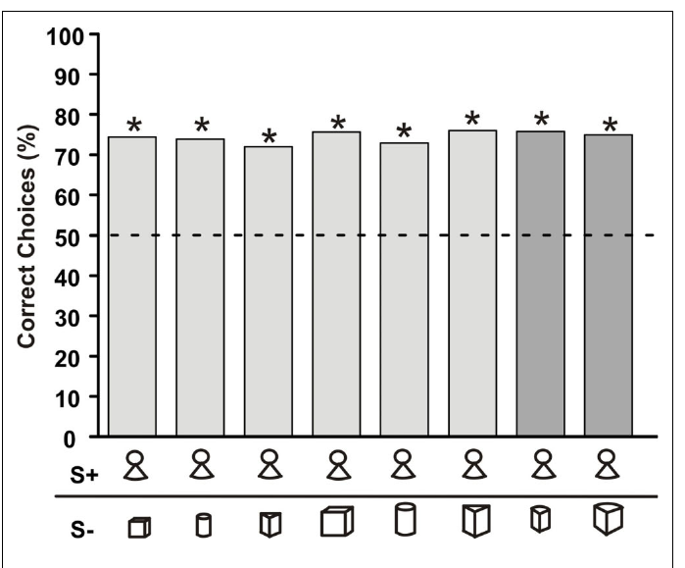
Object choice can generalize to unfamiliar alternatives
Generalization is preservation of a learned response when conditions differ from training. Von der Emde and colleagues trained an elephantnose fish to recognize a compound object consisting of a cone with a sphere above it while varying the alternative object across trials.
After approximately three months of training, the fish preferred the rewarded object against both familiar alternatives and two previously unfamiliar objects. Test trials were neither rewarded nor punished, reducing the possibility that the test itself taught each new comparison.
Recognition therefore did not require memorizing one fixed pair. The experiment supports identification of features associated with the positive object, while leaving open which combination of electrical and movement-dependent cues supplied those features.
von der Emde et al. (2010), Fig. 2. Recognition with familiar and novel negative objects.
von der Emde et al. (2010)
04
Notes:
• Generalization is preservation of a learned response when conditions differ from training. Von der Emde and colleagues trained an elephantnose fish to recognize a compound object consisting of a cone with a sphere above it while varying the alternative object across trials.
• After approximately three months of training, the fish preferred the rewarded object against both familiar alternatives and two previously unfamiliar objects. Test trials were neither rewarded nor punished, reducing the possibility that the test itself taught each new comparison.
• Recognition therefore did not require memorizing one fixed pair. The experiment supports identification of features associated with the positive object, while leaving open which combination of electrical and movement-dependent cues supplied those features.
• The positive object is the rewarded training stimulus, conventionally S+. The negative object, S−, is the alternative; changing S− tests whether learning extends beyond one stimulus pair.
References:
G. von der Emde; K. Behr; B. Bouton; J. Engelmann; S. Fetz; C. Folde (2010). 3-Dimensional scene perception during active electrolocation in a weakly electric pulse fish. Frontiers in Behavioral Neuroscience 4:26. https://doi.org/10.3389/fnbeh.2010.00026
Figure: von der Emde et al. (2010), Fig. 2. Recognition with familiar and novel negative objects.
Figure source: https://doi.org/10.3389/fnbeh.2010.00026

Slide 5
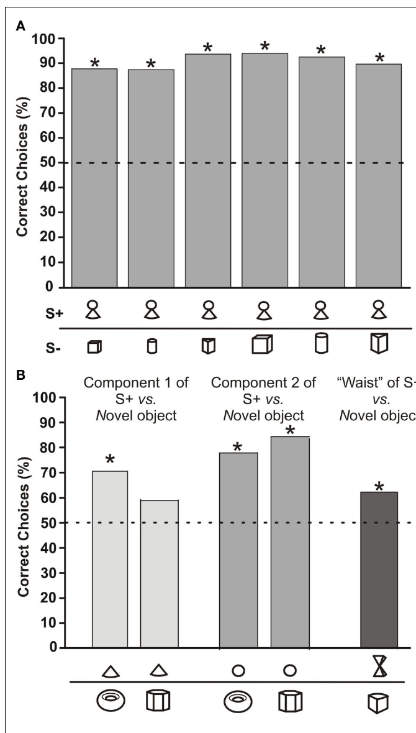
Recognition can depend unequally on object components
A component cue is an identifiable part of a larger object that can contribute to recognition. The compound training object contained a sphere, a cone, and a narrow junction, allowing von der Emde and colleagues to test parts separately against novel alternatives.
The sphere preserved much of the preference obtained with the intact object. The cone produced lower choice frequencies, approximately 70% or 59% depending on the alternative, and a stimulus mimicking the narrow junction also reduced recognition.
The parts were therefore not equally effective. These results support selective use of learned object features, but do not identify a neuron representing a sphere or demonstrate that one part alone explains every recognition condition.
von der Emde et al. (2010), Fig. 3(A–B). Choices for the compound object and its components.
von der Emde et al. (2010)
05
Notes:
• A component cue is an identifiable part of a larger object that can contribute to recognition. The compound training object contained a sphere, a cone, and a narrow junction, allowing von der Emde and colleagues to test parts separately against novel alternatives.
• The sphere preserved much of the preference obtained with the intact object. The cone produced lower choice frequencies, approximately 70% or 59% depending on the alternative, and a stimulus mimicking the narrow junction also reduced recognition.
• The parts were therefore not equally effective. These results support selective use of learned object features, but do not identify a neuron representing a sphere or demonstrate that one part alone explains every recognition condition.
• Removing a component changes the current pattern available to the animal. Part-based behavioral recognition should not be equated with a directly measured neural representation of that part.
References:
G. von der Emde; K. Behr; B. Bouton; J. Engelmann; S. Fetz; C. Folde (2010). 3-Dimensional scene perception during active electrolocation in a weakly electric pulse fish. Frontiers in Behavioral Neuroscience 4:26. https://doi.org/10.3389/fnbeh.2010.00026
Figure: von der Emde et al. (2010), Fig. 3(A–B). Choices for the compound object and its components.
Figure source: https://doi.org/10.3389/fnbeh.2010.00026

Slide 6
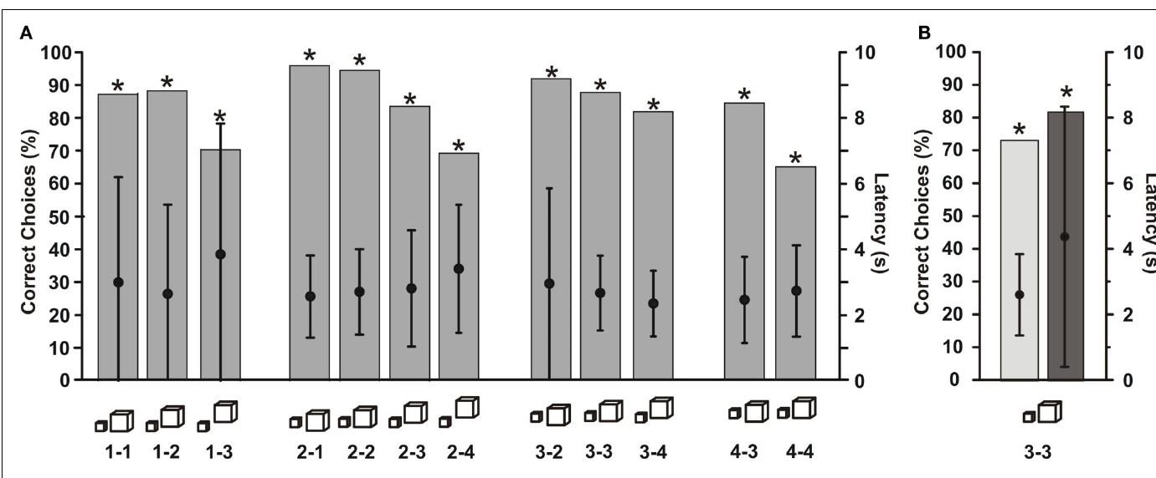
Physical size can be recognized despite image changes
Size constancy means identifying physical object size despite changes in the sensory image caused by distance. Von der Emde and colleagues trained a fish to choose a smaller cube rather than a larger cube, initially placing them 2 cm and 3 cm from the gates, respectively.
The distances of the cubes were then varied independently. The fish continued to prefer the smaller cube across distance combinations, with useful performance extending to approximately 4 cm. Control tests in darkness preserved the size discrimination.
Measured image diameter increased when a small cube moved farther away, so image width alone did not preserve physical size. The behavior supports compensation for distance-dependent sensory changes, without identifying the complete neural computation that produces the compensation.
von der Emde et al. (2010), Fig. 4(A–B). Size-constancy tests across object-distance combinations.
von der Emde et al. (2010)
06
Notes:
• Size constancy means identifying physical object size despite changes in the sensory image caused by distance. Von der Emde and colleagues trained a fish to choose a smaller cube rather than a larger cube, initially placing them 2 cm and 3 cm from the gates, respectively.
• The distances of the cubes were then varied independently. The fish continued to prefer the smaller cube across distance combinations, with useful performance extending to approximately 4 cm. Control tests in darkness preserved the size discrimination.
• Measured image diameter increased when a small cube moved farther away, so image width alone did not preserve physical size. The behavior supports compensation for distance-dependent sensory changes, without identifying the complete neural computation that produces the compensation.
• The distance manipulation prevents a fixed image-intensity rule from consistently matching the rewarded physical size. Size constancy is a behavioral property, not proof of a particular distance estimator.
References:
G. von der Emde; K. Behr; B. Bouton; J. Engelmann; S. Fetz; C. Folde (2010). 3-Dimensional scene perception during active electrolocation in a weakly electric pulse fish. Frontiers in Behavioral Neuroscience 4:26. https://doi.org/10.3389/fnbeh.2010.00026
Figure: von der Emde et al. (2010), Fig. 4(A–B). Size-constancy tests across object-distance combinations.
Figure source: https://doi.org/10.3389/fnbeh.2010.00026

Slide 7
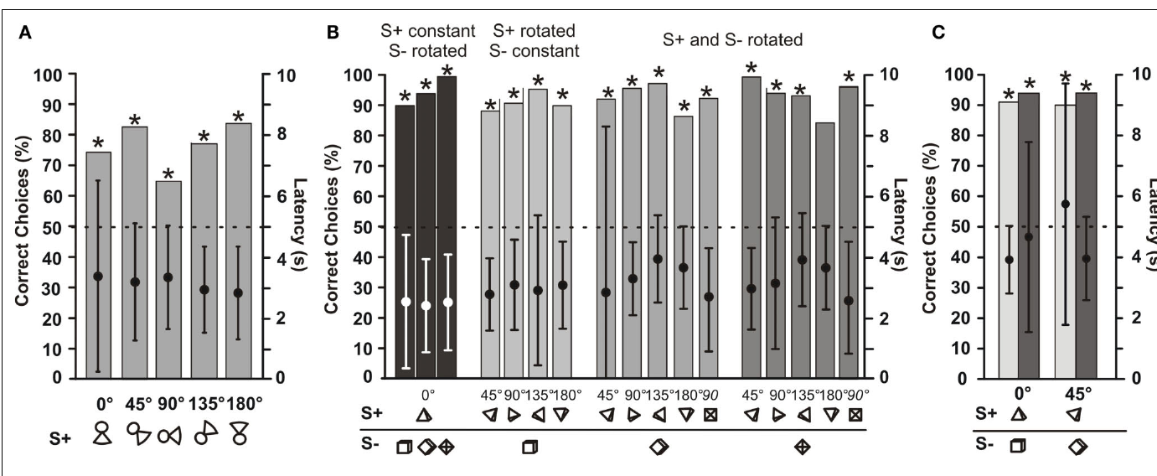
Rotation invariance varies across trained individuals
Rotation invariance is recognition that persists when an object changes orientation in space. Von der Emde and colleagues rotated trained objects through several angles while preserving the choice task, thereby changing the electrical patterns generated during inspection.
A fish trained with the compound object continued to identify it across tested rotations; another trained to choose a pyramid over a cube retained at least 80% correct choices across the tested combinations. Dark-condition controls supported an electrosensory basis for the latter performance.
Other object pairs produced stronger rotation-dependent effects. The findings establish a capacity for orientation-tolerant recognition, while cautioning against treating every fish or learned comparison as equally invariant. The specific geometry and acquired cues remain relevant.
von der Emde et al. (2010), Fig. 5(A–C). Recognition after rotating positive and negative objects.
von der Emde et al. (2010)
07
Notes:
• Rotation invariance is recognition that persists when an object changes orientation in space. Von der Emde and colleagues rotated trained objects through several angles while preserving the choice task, thereby changing the electrical patterns generated during inspection.
• A fish trained with the compound object continued to identify it across tested rotations; another trained to choose a pyramid over a cube retained at least 80% correct choices across the tested combinations. Dark-condition controls supported an electrosensory basis for the latter performance.
• Other object pairs produced stronger rotation-dependent effects. The findings establish a capacity for orientation-tolerant recognition, while cautioning against treating every fish or learned comparison as equally invariant. The specific geometry and acquired cues remain relevant.
• An invariant behavior remains stable across a defined transformation. That does not require all receptor signals to remain unchanged; the transformed input can still support the same object choice.
References:
G. von der Emde; K. Behr; B. Bouton; J. Engelmann; S. Fetz; C. Folde (2010). 3-Dimensional scene perception during active electrolocation in a weakly electric pulse fish. Frontiers in Behavioral Neuroscience 4:26. https://doi.org/10.3389/fnbeh.2010.00026
Figure: von der Emde et al. (2010), Fig. 5(A–C). Recognition after rotating positive and negative objects.
Figure source: https://doi.org/10.3389/fnbeh.2010.00026

Slide 8
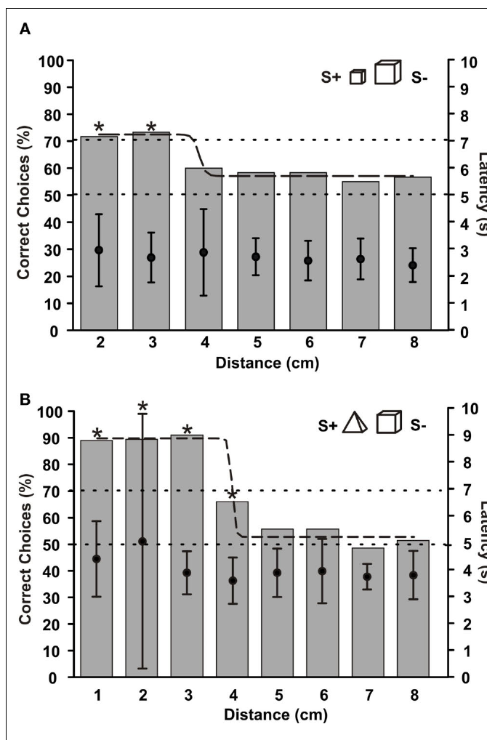
Recognition range differs from mere field propagation
The recognition range is the distance over which an animal can identify a tested object reliably. Von der Emde and colleagues moved metal objects from 1 to 8 cm away from a grid that prevented fish from approaching closer before making their choices.
Performance declined with increasing distance, and the tested shape and size discriminations failed beyond approximately 4 cm. The grid maintained a defined minimum inspection distance rather than allowing the fish to solve every trial by moving directly beside the object.
An electric field can still be physically present beyond this behavioral range. Recognition depends on the usable object-induced perturbation, sensory noise, and the task, so this result should not be interpreted as a universal boundary for all electrosensory detection.
von der Emde et al. (2010), Fig. 7(A–B). Choice performance as object distance increases.
von der Emde et al. (2010)
08
Notes:
• The recognition range is the distance over which an animal can identify a tested object reliably. Von der Emde and colleagues moved metal objects from 1 to 8 cm away from a grid that prevented fish from approaching closer before making their choices.
• Performance declined with increasing distance, and the tested shape and size discriminations failed beyond approximately 4 cm. The grid maintained a defined minimum inspection distance rather than allowing the fish to solve every trial by moving directly beside the object.
• An electric field can still be physically present beyond this behavioral range. Recognition depends on the usable object-induced perturbation, sensory noise, and the task, so this result should not be interpreted as a universal boundary for all electrosensory detection.
• Detection asks whether an object is present; recognition asks which object it is. Their distance limits need not coincide because identification requires additional discriminating information.
References:
G. von der Emde; K. Behr; B. Bouton; J. Engelmann; S. Fetz; C. Folde (2010). 3-Dimensional scene perception during active electrolocation in a weakly electric pulse fish. Frontiers in Behavioral Neuroscience 4:26. https://doi.org/10.3389/fnbeh.2010.00026
Figure: von der Emde et al. (2010), Fig. 7(A–B). Choice performance as object distance increases.
Figure source: https://doi.org/10.3389/fnbeh.2010.00026

Slide 9
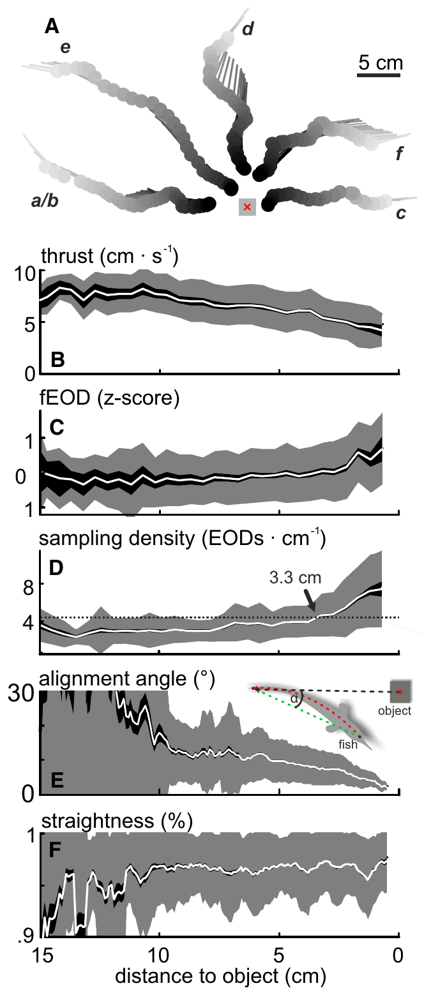
Approach movements change when electric samples arrive
Active sensing includes movements and emission patterns that alter the sensory information acquired by an animal. Hofmann and colleagues tracked spontaneous approaches of elephantnose fish to objects while recording EOD timing in water with conductivity near 100 µS/cm.
As fish approached, thrust decreased while discharge activity and spatial sampling density increased. The fish also became more directly aligned with the object and adopted straighter postures, linking the geometry of inspection to the sequence of electric samples.
These are coordinated behavioral changes rather than a demonstration of one controlling neural pathway. They establish that natural electrolocation input is sampled through changing movements and pulse intervals; a stationary stimulus sequence cannot reproduce every aspect of this sensory situation.
Hofmann et al. (2017), Fig. 1(A–F). Measured movement and discharge patterns during approaches.
Hofmann et al. (2017)
09
Notes:
• Active sensing includes movements and emission patterns that alter the sensory information acquired by an animal. Hofmann and colleagues tracked spontaneous approaches of elephantnose fish to objects while recording EOD timing in water with conductivity near 100 µS/cm.
• As fish approached, thrust decreased while discharge activity and spatial sampling density increased. The fish also became more directly aligned with the object and adopted straighter postures, linking the geometry of inspection to the sequence of electric samples.
• These are coordinated behavioral changes rather than a demonstration of one controlling neural pathway. They establish that natural electrolocation input is sampled through changing movements and pulse intervals; a stationary stimulus sequence cannot reproduce every aspect of this sensory situation.
• Spatial sampling density is the number of electric discharges per distance traveled. It depends jointly on emission timing and swimming speed.
References:
V. Hofmann; J.I. Sanguinetti-Scheck; L. Gómez-Sena; J. Engelmann (2017). Sensory Flow as a Basis for a Novel Distance Cue in Freely Behaving Electric Fish. Journal of Neuroscience 37(2):302–312. https://doi.org/10.1523/JNEUROSCI.1361-16.2016
Figure: Hofmann et al. (2017), Fig. 1(A–F). Measured movement and discharge patterns during approaches.
Figure source: https://doi.org/10.1523/JNEUROSCI.1361-16.2016

Slide 10
Each discharge samples a changing electrical scene
Electrosensory flow is the change in electric input across successive samples as the fish moves relative to objects. Hofmann and colleagues combined measured approach trajectories with a model that reconstructed object-induced current along the fish’s sensory surface.
Successive images changed in amplitude and spatial position. The reconstructed scene therefore supplied both the current electric pattern and its recent history, while measured posture determined which receptors were positioned near the strongest perturbation.
The study did not record the proposed flow signal from a dedicated neuronal population. Its established contribution is a behaviorally constrained description of available information; using that information for object distance remains a mechanistic proposal requiring direct neural or behavioral manipulation.
Hofmann et al. (2017), Fig. 2(A–G). Spatiotemporal electric-image structure during natural behavior.
Hofmann et al. (2017)
10
Notes:
• Electrosensory flow is the change in electric input across successive samples as the fish moves relative to objects. Hofmann and colleagues combined measured approach trajectories with a model that reconstructed object-induced current along the fish’s sensory surface.
• Successive images changed in amplitude and spatial position. The reconstructed scene therefore supplied both the current electric pattern and its recent history, while measured posture determined which receptors were positioned near the strongest perturbation.
• The study did not record the proposed flow signal from a dedicated neuronal population. Its established contribution is a behaviorally constrained description of available information; using that information for object distance remains a mechanistic proposal requiring direct neural or behavioral manipulation.
• The reconstruction omitted some three-dimensional postural variables, including pitch and roll. Consequently, modeled input variability need not include every fluctuation encountered by a freely swimming fish.
References:
V. Hofmann; J.I. Sanguinetti-Scheck; L. Gómez-Sena; J. Engelmann (2017). Sensory Flow as a Basis for a Novel Distance Cue in Freely Behaving Electric Fish. Journal of Neuroscience 37(2):302–312. https://doi.org/10.1523/JNEUROSCI.1361-16.2016
Figure: Hofmann et al. (2017), Fig. 2(A–G). Spatiotemporal electric-image structure during natural behavior.
Figure source: https://doi.org/10.1523/JNEUROSCI.1361-16.2016

Slide 11
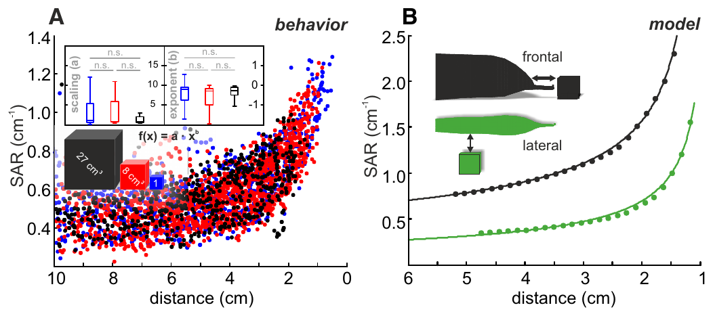
Static image blur is sensitive to inspection geometry
A static distance cue is information available within one sensory sample. Electric-image blur changes with object distance, and the slope-to-amplitude ratio summarizes a spatial property of that image. Hofmann and colleagues evaluated this measure during spontaneous approaches.
The measure varied with distance, but natural changes in posture and body curvature introduced substantial variability. Comparisons with controlled straight approaches separated distance-related structure from variation produced by inspection geometry.
This result does not make static cues unusable. It limits the reliability of a single spatial measurement under the tested natural behaviors and motivates examining information distributed across successive samples, without demonstrating that the fish abandons static cues altogether.
Hofmann et al. (2017), Fig. 3(A–B). Static distance cue during natural approaches and simulations.
Hofmann et al. (2017)
11
Notes:
• A static distance cue is information available within one sensory sample. Electric-image blur changes with object distance, and the slope-to-amplitude ratio summarizes a spatial property of that image. Hofmann and colleagues evaluated this measure during spontaneous approaches.
• The measure varied with distance, but natural changes in posture and body curvature introduced substantial variability. Comparisons with controlled straight approaches separated distance-related structure from variation produced by inspection geometry.
• This result does not make static cues unusable. It limits the reliability of a single spatial measurement under the tested natural behaviors and motivates examining information distributed across successive samples, without demonstrating that the fish abandons static cues altogether.
• Blur refers to the broadening of the electric pattern across the skin. A spatial ratio can reduce some dependence on amplitude while remaining affected by posture and sampling geometry.
References:
V. Hofmann; J.I. Sanguinetti-Scheck; L. Gómez-Sena; J. Engelmann (2017). Sensory Flow as a Basis for a Novel Distance Cue in Freely Behaving Electric Fish. Journal of Neuroscience 37(2):302–312. https://doi.org/10.1523/JNEUROSCI.1361-16.2016
Figure: Hofmann et al. (2017), Fig. 3(A–B). Static distance cue during natural approaches and simulations.
Figure source: https://doi.org/10.1523/JNEUROSCI.1361-16.2016

Slide 12
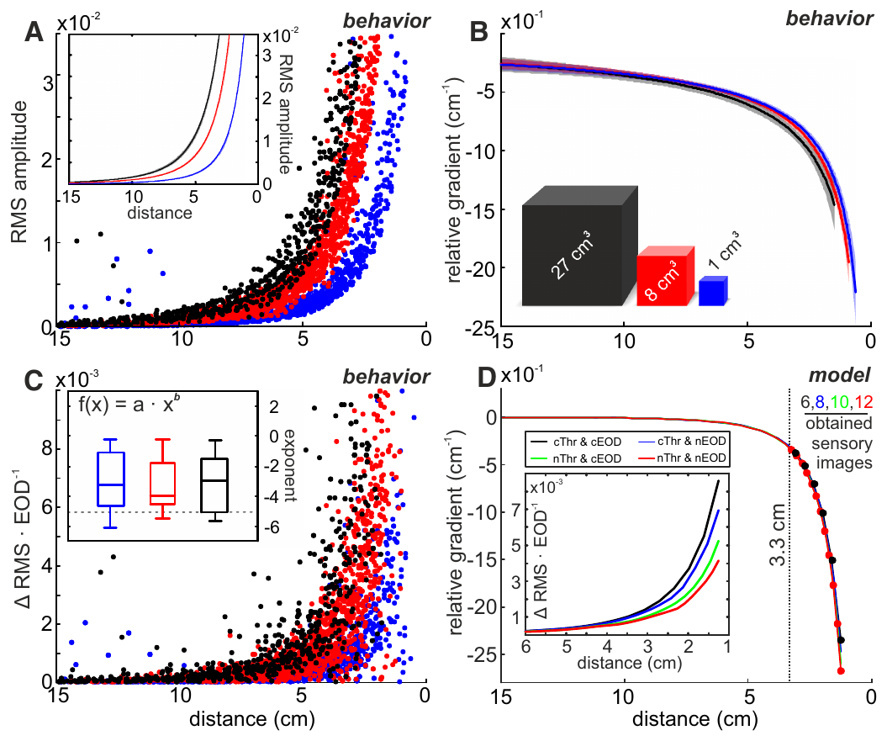
A relative gradient reduces object-size ambiguity
A relative gradient expresses how rapidly electric-image amplitude changes during movement relative to the current amplitude. Hofmann and colleagues reconstructed approaches to differently sized metal cubes and compared absolute image amplitude with this movement-dependent measure.
Absolute amplitude depended strongly on object size. The relative-gradient curves overlapped much more closely across sizes, preserving a systematic relationship with distance. Near the objects, naturally adapted sampling also supplied more measurements than a comparison using unadapted emission and movement patterns.
The finding establishes a candidate cue in the reconstructed sensory input. It does not prove that the fish explicitly divides neuronal signals or that the relative gradient alone explains behavioral distance judgments; the required movement estimate and neural implementation were not directly measured.
Hofmann et al. (2017), Fig. 4(A–D). Amplitude, relative gradient, and sampling during approach.
Hofmann et al. (2017)
12
Notes:
• A relative gradient expresses how rapidly electric-image amplitude changes during movement relative to the current amplitude. Hofmann and colleagues reconstructed approaches to differently sized metal cubes and compared absolute image amplitude with this movement-dependent measure.
• Absolute amplitude depended strongly on object size. The relative-gradient curves overlapped much more closely across sizes, preserving a systematic relationship with distance. Near the objects, naturally adapted sampling also supplied more measurements than a comparison using unadapted emission and movement patterns.
• The finding establishes a candidate cue in the reconstructed sensory input. It does not prove that the fish explicitly divides neuronal signals or that the relative gradient alone explains behavioral distance judgments; the required movement estimate and neural implementation were not directly measured.
• Normalizing a change by the current signal can reduce scale differences across objects. The paper evaluates this operation within its reconstruction, rather than demonstrating a particular cellular arithmetic mechanism.
References:
V. Hofmann; J.I. Sanguinetti-Scheck; L. Gómez-Sena; J. Engelmann (2017). Sensory Flow as a Basis for a Novel Distance Cue in Freely Behaving Electric Fish. Journal of Neuroscience 37(2):302–312. https://doi.org/10.1523/JNEUROSCI.1361-16.2016
Figure: Hofmann et al. (2017), Fig. 4(A–D). Amplitude, relative gradient, and sampling during approach.
Figure source: https://doi.org/10.1523/JNEUROSCI.1361-16.2016

Slide 13
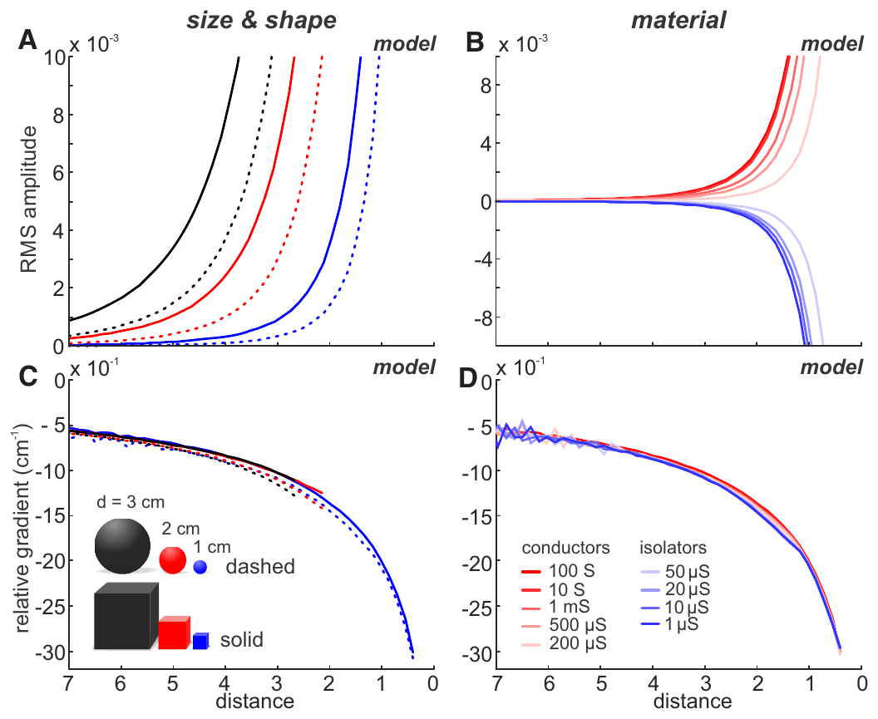
Candidate distance cues can resist material differences
Cue invariance is reduced sensitivity to an irrelevant property while retaining information about the property being estimated. Hofmann and colleagues simulated straight approaches to cubes and spheres with characteristic dimensions of 1, 2, and 3 cm, and varied electrical material properties.
Absolute image amplitude changed markedly with size, shape, and conductivity. Relative-gradient curves overlapped across these modeled conditions, suggesting that distance information could survive changes that strongly alter the absolute signal.
These particular comparisons are simulations, not independent discrimination experiments with every modeled object. They specify the conditions under which the proposed cue is robust, while leaving unresolved whether biological receptor noise, real posture, or additional environmental objects would preserve the same degree of invariance.
Hofmann et al. (2017), Fig. 5(A–D). Published simulations across object size, shape, and material.
Hofmann et al. (2017)
13
Notes:
• Cue invariance is reduced sensitivity to an irrelevant property while retaining information about the property being estimated. Hofmann and colleagues simulated straight approaches to cubes and spheres with characteristic dimensions of 1, 2, and 3 cm, and varied electrical material properties.
• Absolute image amplitude changed markedly with size, shape, and conductivity. Relative-gradient curves overlapped across these modeled conditions, suggesting that distance information could survive changes that strongly alter the absolute signal.
• These particular comparisons are simulations, not independent discrimination experiments with every modeled object. They specify the conditions under which the proposed cue is robust, while leaving unresolved whether biological receptor noise, real posture, or additional environmental objects would preserve the same degree of invariance.
• A result from a published model remains model evidence. It can establish what information the modeled physics contains without proving how an animal reads that information.
References:
V. Hofmann; J.I. Sanguinetti-Scheck; L. Gómez-Sena; J. Engelmann (2017). Sensory Flow as a Basis for a Novel Distance Cue in Freely Behaving Electric Fish. Journal of Neuroscience 37(2):302–312. https://doi.org/10.1523/JNEUROSCI.1361-16.2016
Figure: Hofmann et al. (2017), Fig. 5(A–D). Published simulations across object size, shape, and material.
Figure source: https://doi.org/10.1523/JNEUROSCI.1361-16.2016

Slide 14
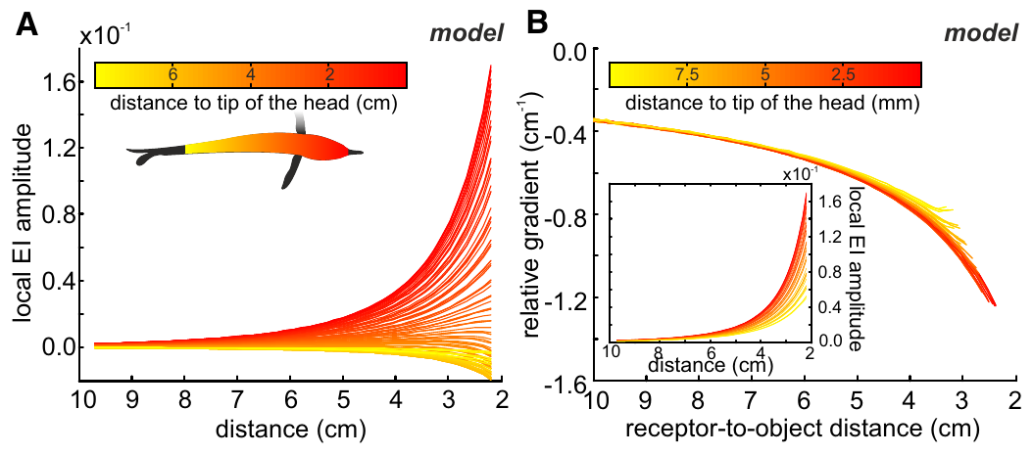
Local sensory position need not define one distance cue
A local amplitude is the object-induced signal measured at a particular point on the sensory surface. Hofmann and colleagues simulated a straight approach to a metal cube with volume 8 cm³ and compared estimates at different positions along the fish’s body.
The local amplitudes differed across positions, while their relative gradients overlapped more closely when distance was expressed relative to the receptor location. The proposed distance information was therefore less tied to one specially selected point on the skin.
This is a property of the tested reconstruction rather than proof that all receptors encode distance identically. Different receptor properties and central readout mechanisms could still weight body regions differently, and the simulation does not establish a uniform neuronal representation of distance.
Hofmann et al. (2017), Fig. 6(A–B). Modeled local amplitudes and relative gradients along the skin.
Hofmann et al. (2017)
14
Notes:
• A local amplitude is the object-induced signal measured at a particular point on the sensory surface. Hofmann and colleagues simulated a straight approach to a metal cube with volume 8 cm³ and compared estimates at different positions along the fish’s body.
• The local amplitudes differed across positions, while their relative gradients overlapped more closely when distance was expressed relative to the receptor location. The proposed distance information was therefore less tied to one specially selected point on the skin.
• This is a property of the tested reconstruction rather than proof that all receptors encode distance identically. Different receptor properties and central readout mechanisms could still weight body regions differently, and the simulation does not establish a uniform neuronal representation of distance.
• The object-to-head distance and the object-to-receptor distance differ for receptors distributed along the body. Distinguishing these references prevents a geometric shift from being mistaken for a change in cue meaning.
References:
V. Hofmann; J.I. Sanguinetti-Scheck; L. Gómez-Sena; J. Engelmann (2017). Sensory Flow as a Basis for a Novel Distance Cue in Freely Behaving Electric Fish. Journal of Neuroscience 37(2):302–312. https://doi.org/10.1523/JNEUROSCI.1361-16.2016
Figure: Hofmann et al. (2017), Fig. 6(A–B). Modeled local amplitudes and relative gradients along the skin.
Figure source: https://doi.org/10.1523/JNEUROSCI.1361-16.2016

Slide 15
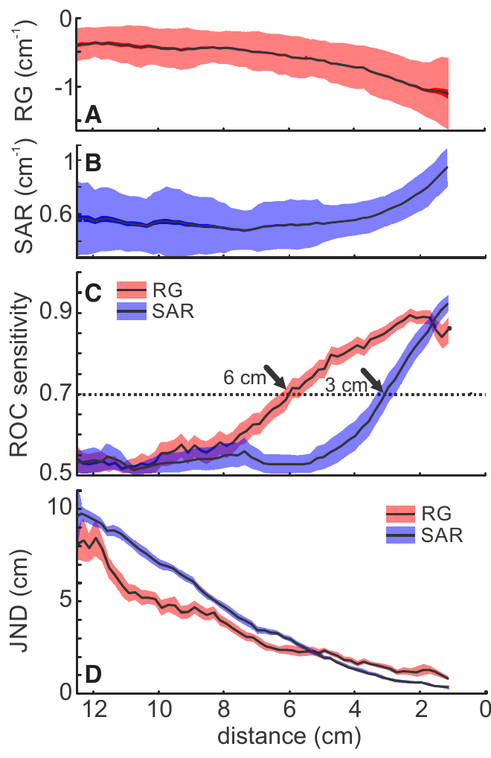
Reconstructed flow outperforms a static cue at range
Hofmann and colleagues compared the discriminability of reconstructed relative-gradient values with that of the static image measure. Both were evaluated against a distant reference condition, preserving a common basis for judging when object-related information emerged from variability.
Under the paper’s defined detection criterion, the relative gradient reached the criterion at approximately 6 cm, whereas the static measure reached it at approximately 3 cm. The dynamic measure also provided finer modeled distance resolution at longer distances.
These values describe cue analysis, not directly observed neural thresholds or behavioral recognition limits. They can coexist with the roughly 4 cm object-recognition range measured in different choice tasks, because identifying shape and extracting a distance-related signal are distinct experimental demands.
Hofmann et al. (2017), Fig. 7(A–D). Comparison of reconstructed dynamic and static distance cues.
Hofmann et al. (2017)
15
Notes:
• Hofmann and colleagues compared the discriminability of reconstructed relative-gradient values with that of the static image measure. Both were evaluated against a distant reference condition, preserving a common basis for judging when object-related information emerged from variability.
• Under the paper’s defined detection criterion, the relative gradient reached the criterion at approximately 6 cm, whereas the static measure reached it at approximately 3 cm. The dynamic measure also provided finer modeled distance resolution at longer distances.
• These values describe cue analysis, not directly observed neural thresholds or behavioral recognition limits. They can coexist with the roughly 4 cm object-recognition range measured in different choice tasks, because identifying shape and extracting a distance-related signal are distinct experimental demands.
• The published comparison uses distributions of reconstructed cue values. Its distance estimates should not be relabeled as measured detection thresholds of the fish.
References:
V. Hofmann; J.I. Sanguinetti-Scheck; L. Gómez-Sena; J. Engelmann (2017). Sensory Flow as a Basis for a Novel Distance Cue in Freely Behaving Electric Fish. Journal of Neuroscience 37(2):302–312. https://doi.org/10.1523/JNEUROSCI.1361-16.2016
Figure: Hofmann et al. (2017), Fig. 7(A–D). Comparison of reconstructed dynamic and static distance cues.
Figure source: https://doi.org/10.1523/JNEUROSCI.1361-16.2016

Slide 16
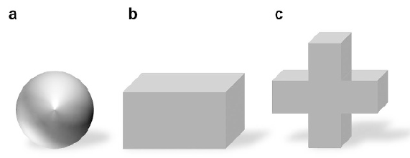
Electrical transparency isolates visual object learning
Electrical transparency means that an object produces little discriminating electrical contrast against the surrounding water. Schumacher and colleagues used colored agarose objects with conductivity close to the tank water to supply visible shapes while reducing active electrolocation cues.
A 3 cm sphere served as the rewarded object, and a cross or cuboid served as the alternative. Metal objects supplied electric contrast; opaque, electrically transparent covers reduced visible shape differences in electric-only conditions. Objects were placed 1 cm behind the gates.
The material and lighting manipulations separated sensory availability while preserving the choice format. Their interpretation depended on control tests of electrical and lateral-line cues, rather than assuming that darkness or matched conductivity automatically isolates every possible sensory contribution.
Schumacher et al. (2017), Fig. 2(a–c). Objects used for multisensory and single-sense conditions.
Schumacher et al. (2017)
16
Notes:
• Electrical transparency means that an object produces little discriminating electrical contrast against the surrounding water. Schumacher and colleagues used colored agarose objects with conductivity close to the tank water to supply visible shapes while reducing active electrolocation cues.
• A 3 cm sphere served as the rewarded object, and a cross or cuboid served as the alternative. Metal objects supplied electric contrast; opaque, electrically transparent covers reduced visible shape differences in electric-only conditions. Objects were placed 1 cm behind the gates.
• The material and lighting manipulations separated sensory availability while preserving the choice format. Their interpretation depended on control tests of electrical and lateral-line cues, rather than assuming that darkness or matched conductivity automatically isolates every possible sensory contribution.
• Agarose is a gel whose conductivity can be adjusted. Matching its measured electrical resistance to water reduced the contrast that an active electric image would otherwise provide.
References:
S. Schumacher; T. Burt de Perera; G. von der Emde (2017). Electrosensory capture during multisensory discrimination of nearby objects in the weakly electric fish Gnathonemus petersii. Scientific Reports 7:43665. https://doi.org/10.1038/srep43665
Figure: Schumacher et al. (2017), Fig. 2(a–c). Objects used for multisensory and single-sense conditions.
Figure source: https://doi.org/10.1038/srep43665

Slide 17
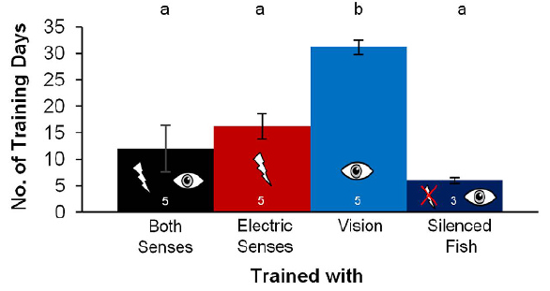
Available senses change the rate of task acquisition
Task acquisition is the development of the learned choice during training. Schumacher and colleagues trained elephantnose fish with both senses, electric information alone, or visual information alone, using a criterion above 75% correct choices on three consecutive training days.
Mean training durations were about 12.5 days with both senses, 16.2 days with electric input, and 31.5 days with visual input in intact fish. Electrically silenced fish learned the visual task in about 6 days under the tested conditions.
The manipulation links emission and sensory context to learning behavior. It does not establish a universal ranking of learning speed across modalities, because experience, available cues, and the near-field object task all constrain the comparison.
Schumacher et al. (2017), Fig. 3. Training duration under different sensory conditions.
Schumacher et al. (2017)
17
Notes:
• Task acquisition is the development of the learned choice during training. Schumacher and colleagues trained elephantnose fish with both senses, electric information alone, or visual information alone, using a criterion above 75% correct choices on three consecutive training days.
• Mean training durations were about 12.5 days with both senses, 16.2 days with electric input, and 31.5 days with visual input in intact fish. Electrically silenced fish learned the visual task in about 6 days under the tested conditions.
• The manipulation links emission and sensory context to learning behavior. It does not establish a universal ranking of learning speed across modalities, because experience, available cues, and the near-field object task all constrain the comparison.
• Electrically silenced fish could not emit their normal sensing pulses. Their visual learning outcome helps separate an effect of electric-sense conflict from a general inability to learn visually.
References:
S. Schumacher; T. Burt de Perera; G. von der Emde (2017). Electrosensory capture during multisensory discrimination of nearby objects in the weakly electric fish Gnathonemus petersii. Scientific Reports 7:43665. https://doi.org/10.1038/srep43665
Figure: Schumacher et al. (2017), Fig. 3. Training duration under different sensory conditions.
Figure source: https://doi.org/10.1038/srep43665

Slide 18
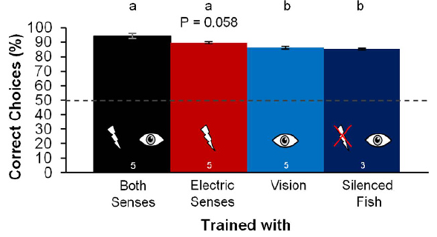
Combined senses improve asymptotic discrimination
Asymptotic performance is the relatively stable accuracy reached after a task has been learned. Schumacher and colleagues compared trained fish under conditions permitting both vision and electrolocation, electrolocation alone, or vision alone, while maintaining the same rewarded-object choice.
Accuracy reached at least 84% in every group. The combined-sense group averaged approximately 94.5% correct choices, exceeding the visual-only accuracy in intact fish. The objects remained close, approximately 1 cm behind the inspection gates.
The result supports a benefit of combined sensory information in this task. It does not establish that every improvement reflects statistically optimal fusion, nor does it identify where in the brain the two modalities converge to influence the choice.
Schumacher et al. (2017), Fig. 4. Accuracy after training under different sensory conditions.
Schumacher et al. (2017)
18
Notes:
• Asymptotic performance is the relatively stable accuracy reached after a task has been learned. Schumacher and colleagues compared trained fish under conditions permitting both vision and electrolocation, electrolocation alone, or vision alone, while maintaining the same rewarded-object choice.
• Accuracy reached at least 84% in every group. The combined-sense group averaged approximately 94.5% correct choices, exceeding the visual-only accuracy in intact fish. The objects remained close, approximately 1 cm behind the inspection gates.
• The result supports a benefit of combined sensory information in this task. It does not establish that every improvement reflects statistically optimal fusion, nor does it identify where in the brain the two modalities converge to influence the choice.
• Training duration and final accuracy describe different aspects of behavior. A modality can support successful discrimination while producing a different acquisition rate or final performance level.
References:
S. Schumacher; T. Burt de Perera; G. von der Emde (2017). Electrosensory capture during multisensory discrimination of nearby objects in the weakly electric fish Gnathonemus petersii. Scientific Reports 7:43665. https://doi.org/10.1038/srep43665
Figure: Schumacher et al. (2017), Fig. 4. Accuracy after training under different sensory conditions.
Figure source: https://doi.org/10.1038/srep43665

Slide 19
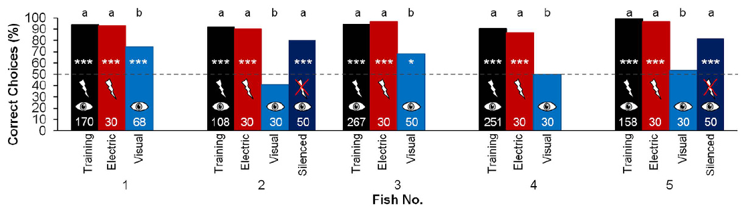
Sensory conflict reveals electrosensory dominance nearby
Electrosensory capture is dominance of electric information over conflicting visual information in a perceptual task. Schumacher and colleagues trained fish with electrically conspicuous metal objects and then tested choices with electric-only or visual-only information available.
At the short inspection distance of 1 cm, electric information strongly supported the trained discrimination, while removing discriminating electric cues could impair use of visual shape. The result depends on the specific near-field task and the animal’s training history.
Dominance is therefore conditional rather than a permanent absence of visual competence. The behavioral tests measure the sensory information controlling choice; they do not directly reveal a synaptic weight, receptor suppression, or a dedicated multisensory neuron.
Schumacher et al. (2017), Fig. 5. Multisensory training followed by single-sense tests.
Schumacher et al. (2017)
19
Notes:
• Electrosensory capture is dominance of electric information over conflicting visual information in a perceptual task. Schumacher and colleagues trained fish with electrically conspicuous metal objects and then tested choices with electric-only or visual-only information available.
• At the short inspection distance of 1 cm, electric information strongly supported the trained discrimination, while removing discriminating electric cues could impair use of visual shape. The result depends on the specific near-field task and the animal’s training history.
• Dominance is therefore conditional rather than a permanent absence of visual competence. The behavioral tests measure the sensory information controlling choice; they do not directly reveal a synaptic weight, receptor suppression, or a dedicated multisensory neuron.
• The term sensory weighting describes the contribution of each modality to the observable decision. A behavioral weight should not be treated as a measured molecular or synaptic parameter.
References:
S. Schumacher; T. Burt de Perera; G. von der Emde (2017). Electrosensory capture during multisensory discrimination of nearby objects in the weakly electric fish Gnathonemus petersii. Scientific Reports 7:43665. https://doi.org/10.1038/srep43665
Figure: Schumacher et al. (2017), Fig. 5. Multisensory training followed by single-sense tests.
Figure source: https://doi.org/10.1038/srep43665

Slide 20
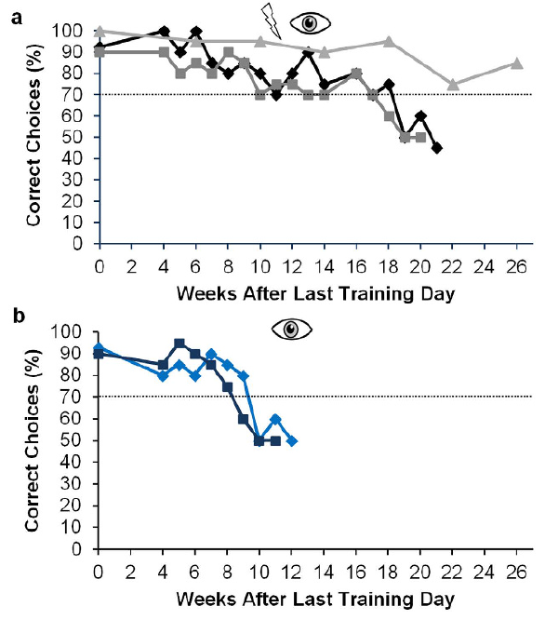
Repeated visual tests can expose a training conflict
A training conflict occurs when one available sensory stream carries the learned distinguishing features while another offers little useful contrast. Schumacher and colleagues repeatedly tested visual object discrimination after training that emphasized electrically conspicuous objects.
The longitudinal tests documented changes in visual-only performance across weeks of training. Comparisons of combined-sense and visual conditions preserved the near-field choice task, while electrically transparent stimuli reduced the previously useful electric distinction.
The results support experience-dependent sensory weighting, including interference from electric information under particular training conditions. They do not demonstrate that active electrolocation always prevents visual learning: visually trained and electrically silenced fish could learn the task, and stimulus reliability remained a defining factor.
Schumacher et al. (2017), Fig. 7(a–b). Choice changes across continued training and visual tests.
Schumacher et al. (2017)
20
Notes:
• A training conflict occurs when one available sensory stream carries the learned distinguishing features while another offers little useful contrast. Schumacher and colleagues repeatedly tested visual object discrimination after training that emphasized electrically conspicuous objects.
• The longitudinal tests documented changes in visual-only performance across weeks of training. Comparisons of combined-sense and visual conditions preserved the near-field choice task, while electrically transparent stimuli reduced the previously useful electric distinction.
• The results support experience-dependent sensory weighting, including interference from electric information under particular training conditions. They do not demonstrate that active electrolocation always prevents visual learning: visually trained and electrically silenced fish could learn the task, and stimulus reliability remained a defining factor.
• Repeated measurements track performance in the same behavioral context. Changes across weeks need not specify the location or cellular mechanism of the underlying plasticity.
References:
S. Schumacher; T. Burt de Perera; G. von der Emde (2017). Electrosensory capture during multisensory discrimination of nearby objects in the weakly electric fish Gnathonemus petersii. Scientific Reports 7:43665. https://doi.org/10.1038/srep43665
Figure: Schumacher et al. (2017), Fig. 7(a–b). Choice changes across continued training and visual tests.
Figure source: https://doi.org/10.1038/srep43665

Slide 21
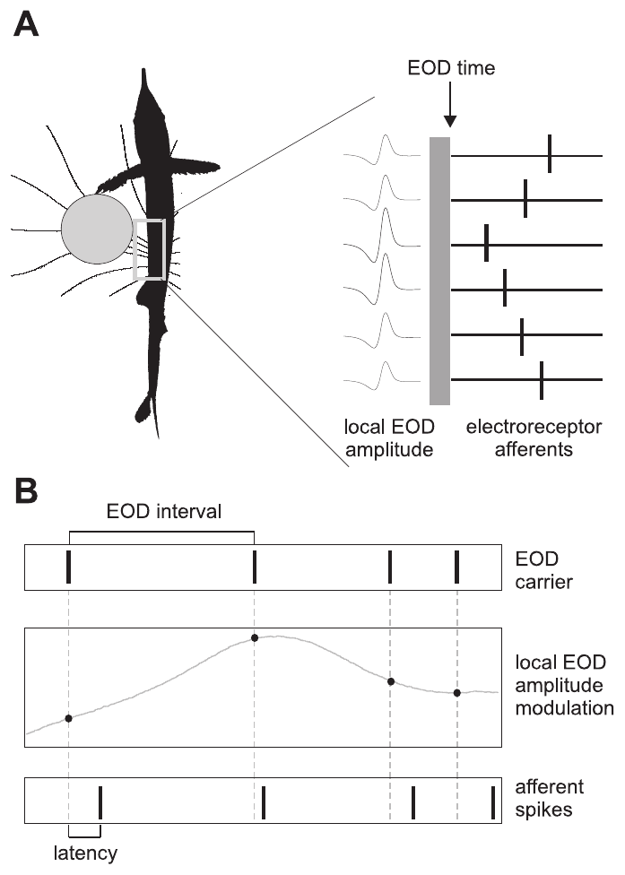
Mormyromast afferents encode amplitude through timing
A mormyromast is an electroreceptor organ used in mormyrid active electrolocation. Its sensory afferent carries information from the skin toward the brain. Spike latency is the interval between the electric stimulus and the first recorded afferent action potential.
Sawtell and colleagues varied local electric-pulse amplitude and pulse timing while recording afferent spikes. Their brief stimuli mimicked an EOD, allowing amplitude changes associated with objects to be examined separately from changes in the sampling interval.
An amplitude increase generally shortened first-spike latency. Thus, receptor input is represented partly by when a spike occurs, not simply by how many spikes occur. This temporal representation still depends on the recent sequence of sensing events.
Sawtell et al. (2006), Fig. 1(A–B). Spatial receptor input and controlled sensing-interval stimuli.
Sawtell et al. (2006)
21
Notes:
• A mormyromast is an electroreceptor organ used in mormyrid active electrolocation. Its sensory afferent carries information from the skin toward the brain. Spike latency is the interval between the electric stimulus and the first recorded afferent action potential.
• Sawtell and colleagues varied local electric-pulse amplitude and pulse timing while recording afferent spikes. Their brief stimuli mimicked an EOD, allowing amplitude changes associated with objects to be examined separately from changes in the sampling interval.
• An amplitude increase generally shortened first-spike latency. Thus, receptor input is represented partly by when a spike occurs, not simply by how many spikes occur. This temporal representation still depends on the recent sequence of sensing events.
• An afferent action potential is the propagated electrical output of the sensory fiber. The latency code refers to its timing relative to a controlled electric pulse, not to object distance measured directly.
References:
N.B. Sawtell; A. Williams; P.D. Roberts; G. von der Emde; C.C. Bell (2006). Effects of Sensing Behavior on a Latency Code. Journal of Neuroscience 26(32):8221–8234. https://doi.org/10.1523/JNEUROSCI.1508-06.2006
Figure: Sawtell et al. (2006), Fig. 1(A–B). Spatial receptor input and controlled sensing-interval stimuli.
Figure source: https://doi.org/10.1523/JNEUROSCI.1508-06.2006

Slide 22
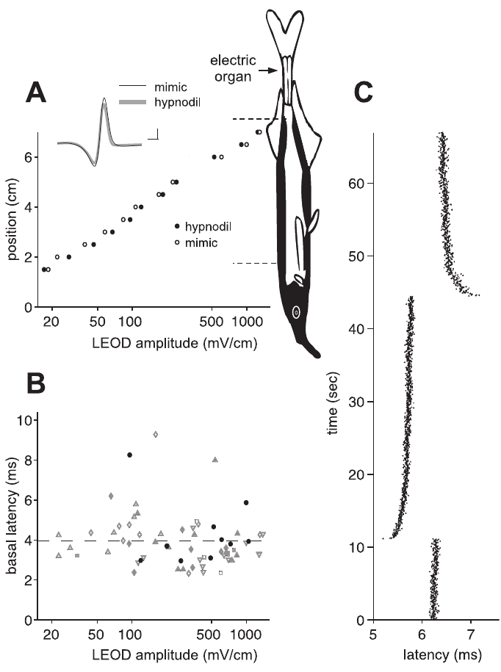
Sensory adaptation changes the amplitude reference
Adaptation is a change in responsiveness associated with recent stimulation. Sawtell and colleagues compared afferent responses over different mean local EOD amplitudes, distinguishing the steady carrier level from smaller amplitude changes superimposed on it.
The latency relationship shifted with the mean electric stimulus. Responses were therefore not determined solely by the instantaneous voltage at a receptor; the preceding stimulus environment established part of the reference against which amplitude modulation was encoded.
This result concerns adaptation within the recorded afferent pathway. It does not identify one molecular adaptation mechanism or establish that every receptor adjusts identically. A central decoder must account for the fact that the same immediate amplitude can occur under different sensory histories.
Sawtell et al. (2006), Fig. 2(A–C). Latency adaptation to the mean local electric amplitude.
Sawtell et al. (2006)
22
Notes:
• Adaptation is a change in responsiveness associated with recent stimulation. Sawtell and colleagues compared afferent responses over different mean local EOD amplitudes, distinguishing the steady carrier level from smaller amplitude changes superimposed on it.
• The latency relationship shifted with the mean electric stimulus. Responses were therefore not determined solely by the instantaneous voltage at a receptor; the preceding stimulus environment established part of the reference against which amplitude modulation was encoded.
• This result concerns adaptation within the recorded afferent pathway. It does not identify one molecular adaptation mechanism or establish that every receptor adjusts identically. A central decoder must account for the fact that the same immediate amplitude can occur under different sensory histories.
• The carrier is the baseline pulse amplitude. Modulation is the deviation from that baseline; separating them avoids conflating object-related changes with a different overall stimulation level.
References:
N.B. Sawtell; A. Williams; P.D. Roberts; G. von der Emde; C.C. Bell (2006). Effects of Sensing Behavior on a Latency Code. Journal of Neuroscience 26(32):8221–8234. https://doi.org/10.1523/JNEUROSCI.1508-06.2006
Figure: Sawtell et al. (2006), Fig. 2(A–C). Latency adaptation to the mean local electric amplitude.
Figure source: https://doi.org/10.1523/JNEUROSCI.1508-06.2006

Slide 23
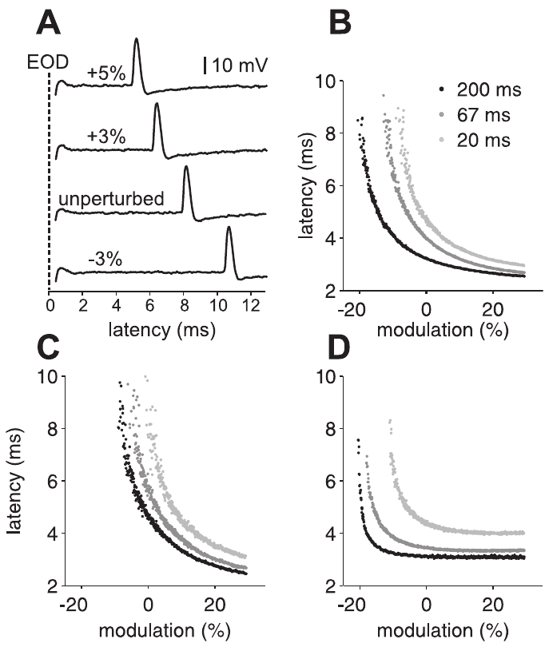
Pulse interval shifts the latency–amplitude relationship
An inter-discharge interval is the time between successive sensing pulses. Sawtell and colleagues ramped pulse amplitude from approximately −30% to +30% while presenting pulses at fixed intervals of 200, 67, or 20 ms, then recorded afferent first-spike latency.
Increasing amplitude shortened latency, but shorter sensing intervals produced longer latencies at the same amplitude. Individual afferents differed in the slope and position of their latency–amplitude relationships, so the interval effect did not amount to one identical offset for all fibers.
The motor sampling pattern therefore influences the sensory code before central decoding. A latency shift cannot automatically be assigned to an object-induced amplitude change without considering how recently the receptor was stimulated.
Sawtell et al. (2006), Fig. 3(A–D). First-spike latency across amplitude ramps and pulse intervals.
Sawtell et al. (2006)
23
Notes:
• An inter-discharge interval is the time between successive sensing pulses. Sawtell and colleagues ramped pulse amplitude from approximately −30% to +30% while presenting pulses at fixed intervals of 200, 67, or 20 ms, then recorded afferent first-spike latency.
• Increasing amplitude shortened latency, but shorter sensing intervals produced longer latencies at the same amplitude. Individual afferents differed in the slope and position of their latency–amplitude relationships, so the interval effect did not amount to one identical offset for all fibers.
• The motor sampling pattern therefore influences the sensory code before central decoding. A latency shift cannot automatically be assigned to an object-induced amplitude change without considering how recently the receptor was stimulated.
• The experiment held interval constant within each ramp. Comparing ramps across intervals isolates an effect of pulse spacing from the amplitude dependence within a ramp.
References:
N.B. Sawtell; A. Williams; P.D. Roberts; G. von der Emde; C.C. Bell (2006). Effects of Sensing Behavior on a Latency Code. Journal of Neuroscience 26(32):8221–8234. https://doi.org/10.1523/JNEUROSCI.1508-06.2006
Figure: Sawtell et al. (2006), Fig. 3(A–D). First-spike latency across amplitude ramps and pulse intervals.
Figure source: https://doi.org/10.1523/JNEUROSCI.1508-06.2006

Slide 24
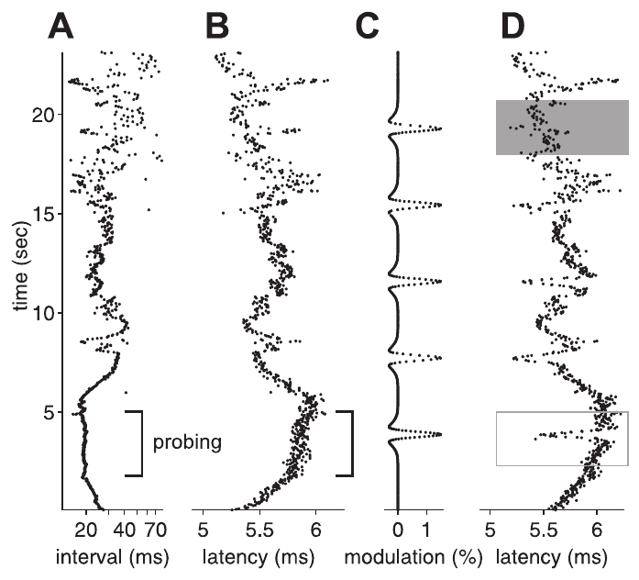
Natural sampling histories alter afferent responses
A sampling history is the sequence of preceding pulses rather than only the latest interval. Sawtell and colleagues replayed natural patterns of EOD intervals while measuring first-spike latency and comparing responses with controlled amplitude modulation.
The afferent latency changed as the natural pulse sequence changed, even when an instantaneous amplitude alone could not account for the response. The measured code therefore reflected the time structure of active sampling as well as the electrical contrast being sampled.
The replay experiment directly establishes history dependence at the sensory afferent. It does not measure the animal’s decision during those recordings, and it does not imply that the central nervous system necessarily reconstructs every prior interval explicitly.
Sawtell et al. (2006), Fig. 4(A–D). Afferent latencies under natural sensing-interval sequences.
Sawtell et al. (2006)
24
Notes:
• A sampling history is the sequence of preceding pulses rather than only the latest interval. Sawtell and colleagues replayed natural patterns of EOD intervals while measuring first-spike latency and comparing responses with controlled amplitude modulation.
• The afferent latency changed as the natural pulse sequence changed, even when an instantaneous amplitude alone could not account for the response. The measured code therefore reflected the time structure of active sampling as well as the electrical contrast being sampled.
• The replay experiment directly establishes history dependence at the sensory afferent. It does not measure the animal’s decision during those recordings, and it does not imply that the central nervous system necessarily reconstructs every prior interval explicitly.
• Replaying a natural sequence preserves temporal structure that fixed-rate stimulation removes. The experimental separation permits response changes to be attributed to sampling history under controlled input conditions.
References:
N.B. Sawtell; A. Williams; P.D. Roberts; G. von der Emde; C.C. Bell (2006). Effects of Sensing Behavior on a Latency Code. Journal of Neuroscience 26(32):8221–8234. https://doi.org/10.1523/JNEUROSCI.1508-06.2006
Figure: Sawtell et al. (2006), Fig. 4(A–D). Afferent latencies under natural sensing-interval sequences.
Figure source: https://doi.org/10.1523/JNEUROSCI.1508-06.2006

Slide 25
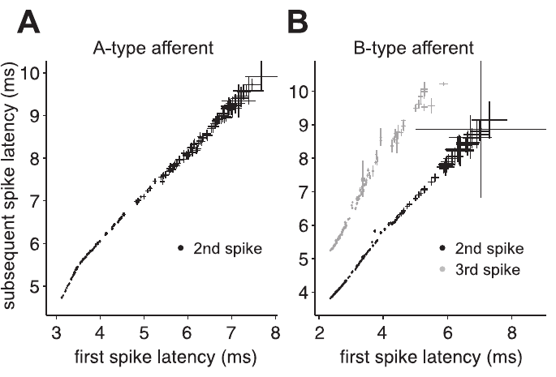
Later afferent spikes largely follow the first spike
A spike train is a sequence of action potentials emitted by one neuron. Some recorded mormyromast afferents produced more than one spike after a pulse, raising the possibility that later spikes might provide additional independent information about local electric amplitude.
Sawtell and colleagues compared the times of subsequent spikes with the first-spike latency. Their tight relationships supported treating the first spike as the principal effective timing variable for the responses examined, rather than regarding every spike as an independent new estimate.
This result narrows the coding description under the tested conditions. It does not imply that later spikes have no synaptic impact; multiple spikes can still influence transmission even when their timing contributes little independent stimulus information.
Sawtell et al. (2006), Fig. 5(A–B). Relationships between first and subsequent afferent spike times.
Sawtell et al. (2006)
25
Notes:
• A spike train is a sequence of action potentials emitted by one neuron. Some recorded mormyromast afferents produced more than one spike after a pulse, raising the possibility that later spikes might provide additional independent information about local electric amplitude.
• Sawtell and colleagues compared the times of subsequent spikes with the first-spike latency. Their tight relationships supported treating the first spike as the principal effective timing variable for the responses examined, rather than regarding every spike as an independent new estimate.
• This result narrows the coding description under the tested conditions. It does not imply that later spikes have no synaptic impact; multiple spikes can still influence transmission even when their timing contributes little independent stimulus information.
• Independent information is different from physiological influence. A later spike can drive a postsynaptic response while remaining strongly predictable from the first-spike latency.
References:
N.B. Sawtell; A. Williams; P.D. Roberts; G. von der Emde; C.C. Bell (2006). Effects of Sensing Behavior on a Latency Code. Journal of Neuroscience 26(32):8221–8234. https://doi.org/10.1523/JNEUROSCI.1508-06.2006
Figure: Sawtell et al. (2006), Fig. 5(A–B). Relationships between first and subsequent afferent spike times.
Figure source: https://doi.org/10.1523/JNEUROSCI.1508-06.2006

Slide 26
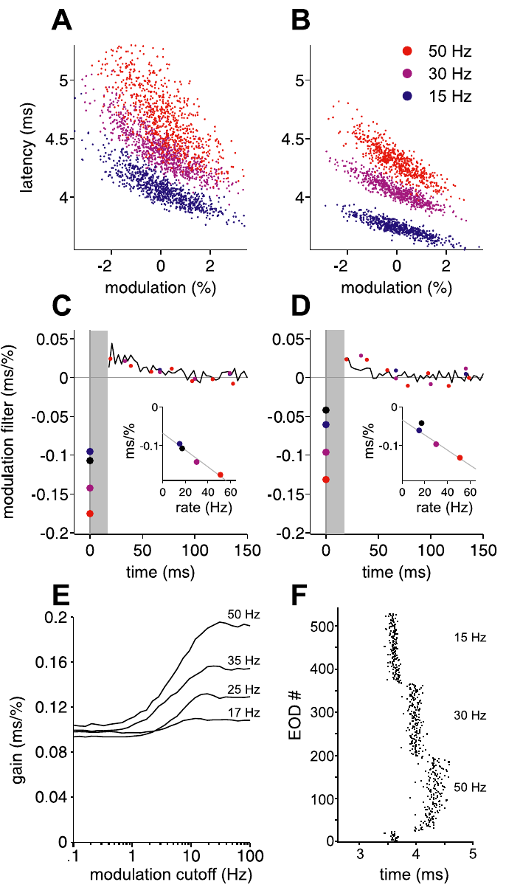
Afferent sensitivity changes with sustained sampling rate
Sensitivity here means the change in afferent latency associated with a given amplitude modulation. Sawtell and colleagues compared responses at constant pulse rates, including 15, 30, and 50 Hz, while estimating how current and previous amplitudes influenced timing.
Sensitivity to present amplitude increased with constant sensing rate. This rate dependence differed from what a fixed linear filter estimated under another stimulation regime would predict, particularly when amplitude changes were correlated across successive pulses.
The result identifies a state-dependent sensory transformation rather than a uniform gain attached permanently to a fiber. It supports adjusting coding models for sampling rate, without establishing that the animal has conscious access to rate or that one receptor channel alone produces the effect.
Sawtell et al. (2006), Fig. 11(A–F). Amplitude sensitivity and filters at constant EOD rates.
Sawtell et al. (2006)
26
Notes:
• Sensitivity here means the change in afferent latency associated with a given amplitude modulation. Sawtell and colleagues compared responses at constant pulse rates, including 15, 30, and 50 Hz, while estimating how current and previous amplitudes influenced timing.
• Sensitivity to present amplitude increased with constant sensing rate. This rate dependence differed from what a fixed linear filter estimated under another stimulation regime would predict, particularly when amplitude changes were correlated across successive pulses.
• The result identifies a state-dependent sensory transformation rather than a uniform gain attached permanently to a fiber. It supports adjusting coding models for sampling rate, without establishing that the animal has conscious access to rate or that one receptor channel alone produces the effect.
• Gain refers to the size of a response change per input change. A fixed filter can approximate one regime while failing when gain changes under another temporal stimulation regime.
References:
N.B. Sawtell; A. Williams; P.D. Roberts; G. von der Emde; C.C. Bell (2006). Effects of Sensing Behavior on a Latency Code. Journal of Neuroscience 26(32):8221–8234. https://doi.org/10.1523/JNEUROSCI.1508-06.2006
Figure: Sawtell et al. (2006), Fig. 11(A–F). Amplitude sensitivity and filters at constant EOD rates.
Figure source: https://doi.org/10.1523/JNEUROSCI.1508-06.2006

Slide 27
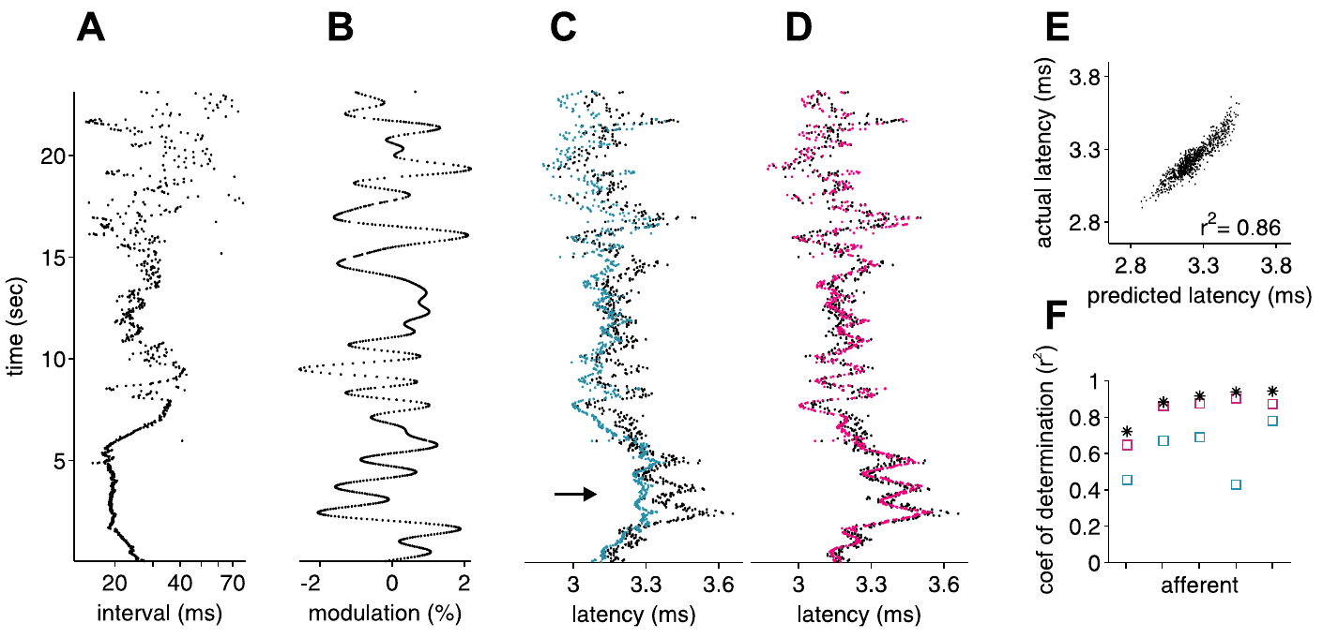
History-aware models improve latency predictions
A coding model predicts neuronal responses from specified stimulus variables. Sawtell and colleagues tested models using both EOD amplitude and prior intervals, then examined prediction failures when natural interval patterns were combined with slowly correlated amplitude changes.
Incorporating interval-dependent changes in amplitude sensitivity improved predictions of measured afferent latencies. The comparison retained the same recorded responses, so the improvement came from accounting for sensory context rather than collecting a different type of neural output.
These are published models fitted to experimental afferent data. Their success supports a description of history-dependent coding, but does not establish the exact cellular mechanism or prove that the downstream ELL performs the same mathematical operations as the fitted model.
Sawtell et al. (2006), Fig. 12(A–F). Published predictions incorporating interval-dependent sensitivity.
Sawtell et al. (2006)
27
Notes:
• A coding model predicts neuronal responses from specified stimulus variables. Sawtell and colleagues tested models using both EOD amplitude and prior intervals, then examined prediction failures when natural interval patterns were combined with slowly correlated amplitude changes.
• Incorporating interval-dependent changes in amplitude sensitivity improved predictions of measured afferent latencies. The comparison retained the same recorded responses, so the improvement came from accounting for sensory context rather than collecting a different type of neural output.
• These are published models fitted to experimental afferent data. Their success supports a description of history-dependent coding, but does not establish the exact cellular mechanism or prove that the downstream ELL performs the same mathematical operations as the fitted model.
• A model prediction should remain distinct from an observed spike latency. Agreement constrains possible coding mechanisms; it does not by itself identify the implementation in a neuron.
References:
N.B. Sawtell; A. Williams; P.D. Roberts; G. von der Emde; C.C. Bell (2006). Effects of Sensing Behavior on a Latency Code. Journal of Neuroscience 26(32):8221–8234. https://doi.org/10.1523/JNEUROSCI.1508-06.2006
Figure: Sawtell et al. (2006), Fig. 12(A–F). Published predictions incorporating interval-dependent sensitivity.
Figure source: https://doi.org/10.1523/JNEUROSCI.1508-06.2006

Slide 28
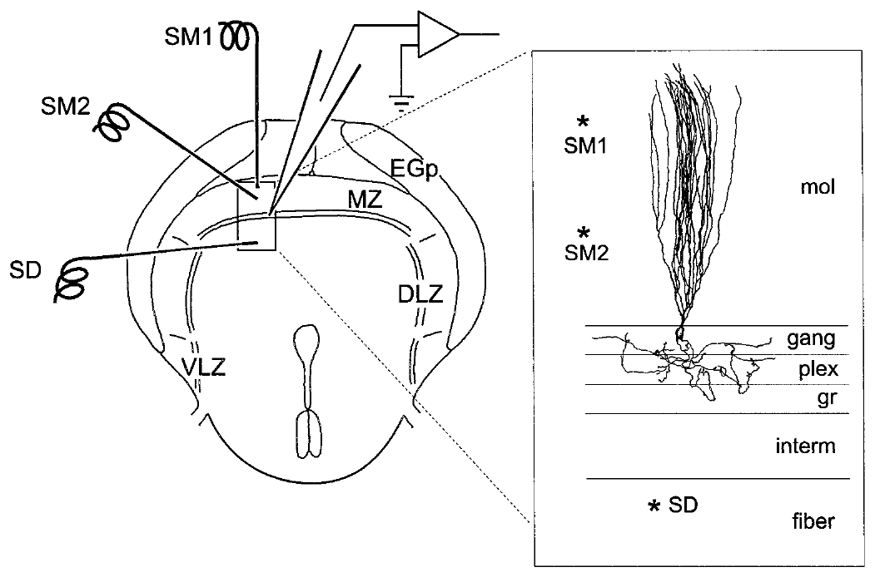
ELL integrates peripheral and descending synaptic input
The electrosensory lateral line lobe, or ELL, is a hindbrain structure receiving input from skin electroreceptors. Grant and colleagues studied elephantnose ELL slices, recording cells intracellularly and stimulating deep afferent pathways separately from molecular-layer parallel fibers.
Parallel fibers are axons carrying central information across the apical dendrites of ELL neurons. The slice preparation preserved the organization needed to compare these inputs while using brief 0.1 ms stimulation pulses and receptor antagonists.
The experiments establish local synaptic properties in a controlled preparation. They do not reproduce the complete freely moving animal, and electrical tract stimulation can recruit more than one input. Anatomical identification and pharmacology constrain which pathways and receptors contribute to the recorded response.
Grant et al. (1998), Fig. 1. Published slice anatomy and stimulation pathways.
Grant et al. (1998)
28
Notes:
• The electrosensory lateral line lobe, or ELL, is a hindbrain structure receiving input from skin electroreceptors. Grant and colleagues studied elephantnose ELL slices, recording cells intracellularly and stimulating deep afferent pathways separately from molecular-layer parallel fibers.
• Parallel fibers are axons carrying central information across the apical dendrites of ELL neurons. The slice preparation preserved the organization needed to compare these inputs while using brief 0.1 ms stimulation pulses and receptor antagonists.
• The experiments establish local synaptic properties in a controlled preparation. They do not reproduce the complete freely moving animal, and electrical tract stimulation can recruit more than one input. Anatomical identification and pharmacology constrain which pathways and receptors contribute to the recorded response.
• Intracellular recording measures membrane voltage inside a cell. The anatomical reconstruction links a recorded response to tissue layers and cell type rather than inferring identity from waveform alone.
References:
K. Grant; Y. Sugawara; L. Gómez; V.Z. Han; C.C. Bell (1998). The Mormyrid Electrosensory Lobe In Vitro: Physiology and Pharmacology of Cells and Circuits. Journal of Neuroscience 18(15):6009–6025. https://doi.org/10.1523/JNEUROSCI.18-15-06009.1998
Figure: Grant et al. (1998), Fig. 1. Published slice anatomy and stimulation pathways.
Figure source: https://doi.org/10.1523/JNEUROSCI.18-15-06009.1998

Slide 29
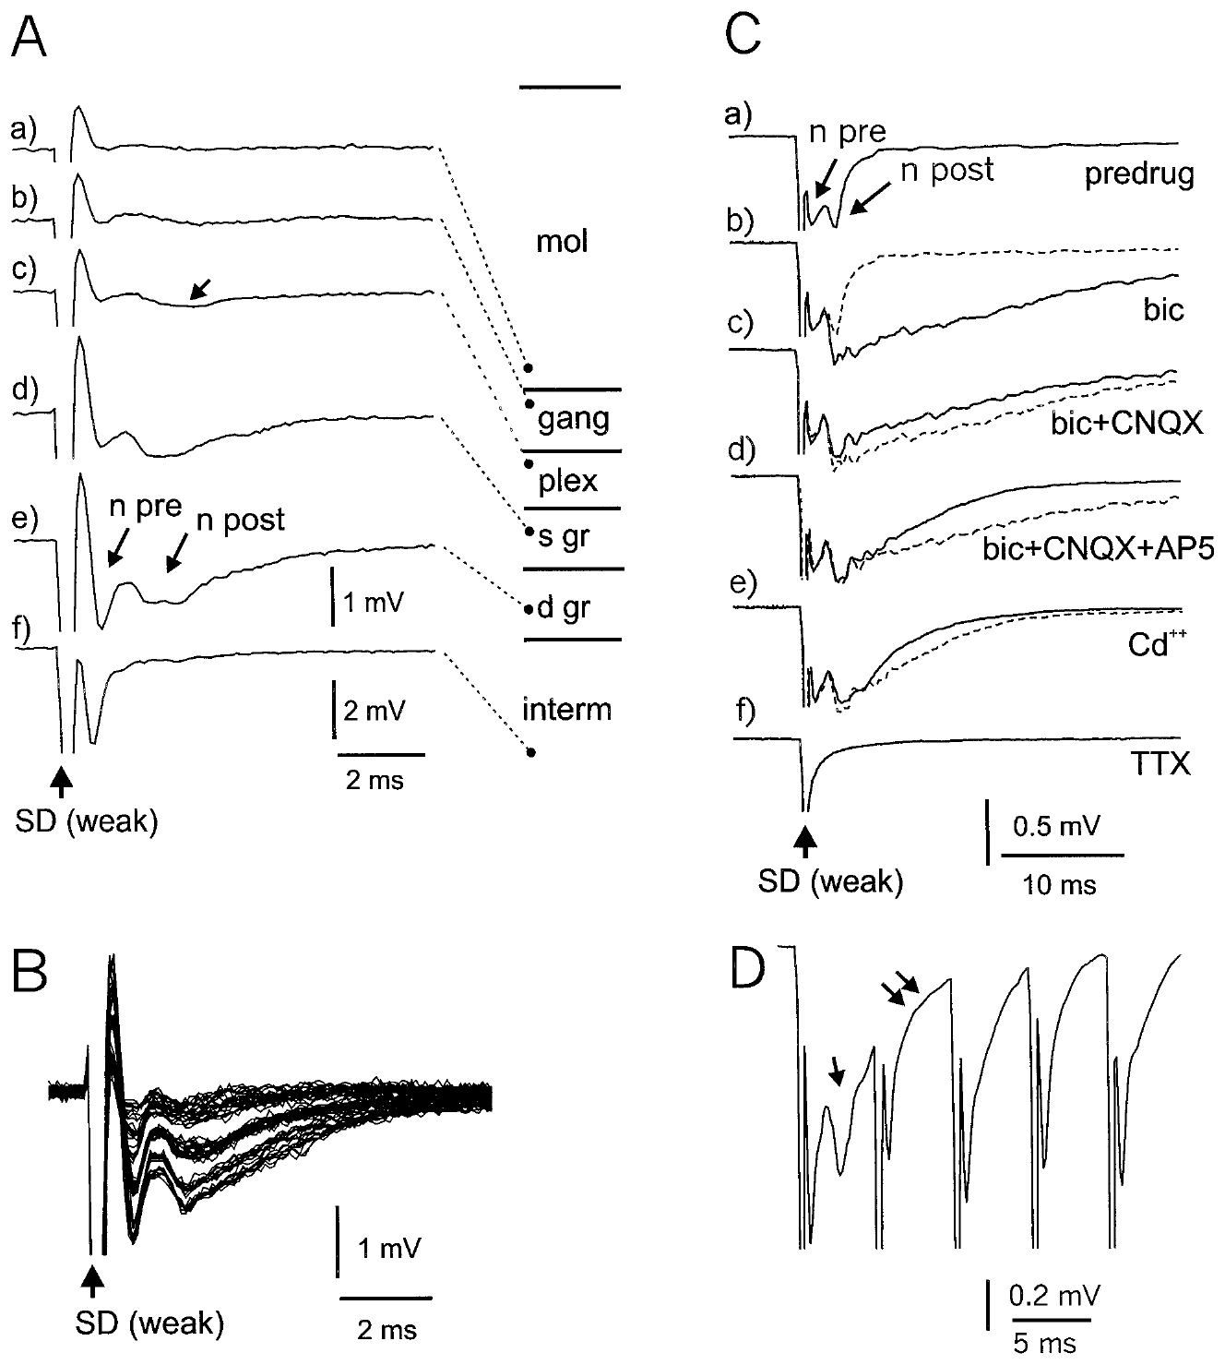
Afferent volleys precede postsynaptic ELL responses
A field potential is an extracellular voltage generated by nearby neural activity. Grant and colleagues stimulated deep ELL layers and separated an early afferent volley from a later postsynaptic component by recording across tissue layers and applying channel blockers.
Cadmium, which blocks calcium-dependent synaptic transmission in this preparation, removed the postsynaptic component while leaving the afferent component. Tetrodotoxin removed the remaining component, consistent with action potentials propagating through sodium-channel-dependent afferent fibers.
The sequence separates arriving spikes from the local response they evoke. It does not identify every contributing synapse from the field waveform alone, but the pharmacological dissociation provides stronger evidence than assigning a mechanism solely from response latency or polarity.
Grant et al. (1998), Fig. 2(A–D). Deep-layer field responses and pharmacological separation.
Grant et al. (1998), Fig. 1. ELL layers and input pathways in the slice.
Grant et al. (1998)
29
Notes:
• A field potential is an extracellular voltage generated by nearby neural activity. Grant and colleagues stimulated deep ELL layers and separated an early afferent volley from a later postsynaptic component by recording across tissue layers and applying channel blockers.
• Cadmium, which blocks calcium-dependent synaptic transmission in this preparation, removed the postsynaptic component while leaving the afferent component. Tetrodotoxin removed the remaining component, consistent with action potentials propagating through sodium-channel-dependent afferent fibers.
• The sequence separates arriving spikes from the local response they evoke. It does not identify every contributing synapse from the field waveform alone, but the pharmacological dissociation provides stronger evidence than assigning a mechanism solely from response latency or polarity.
• A volley is activity arriving across a group of afferent fibers. Calcium-channel dependence of synaptic transmission differs from sodium-channel dependence of the propagated action potential.
References:
K. Grant; Y. Sugawara; L. Gómez; V.Z. Han; C.C. Bell (1998). The Mormyrid Electrosensory Lobe In Vitro: Physiology and Pharmacology of Cells and Circuits. Journal of Neuroscience 18(15):6009–6025. https://doi.org/10.1523/JNEUROSCI.18-15-06009.1998
Figure: Grant et al. (1998), Fig. 2(A–D). Deep-layer field responses and pharmacological separation.
Figure source: https://doi.org/10.1523/JNEUROSCI.18-15-06009.1998
Figure: Grant et al. (1998), Fig. 1. ELL layers and input pathways in the slice.
Figure source: https://doi.org/10.1523/JNEUROSCI.18-15-06009.1998

Slide 30
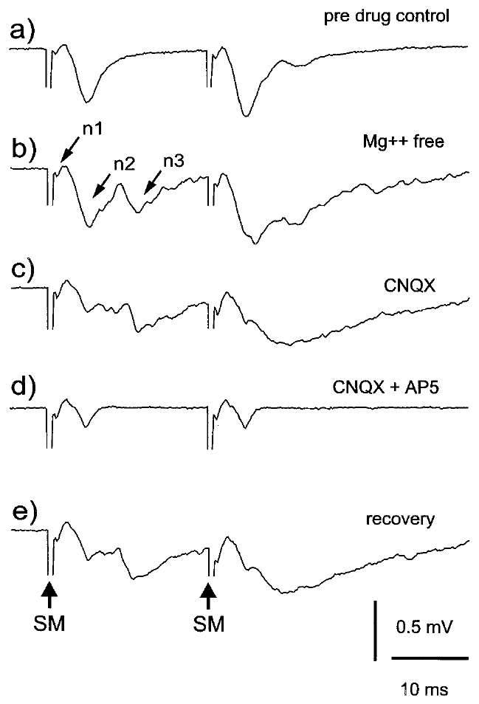
Glutamate receptors mediate excitatory ELL responses
An excitatory postsynaptic potential, or EPSP, is a synaptically evoked voltage change favoring neuronal firing. Grant and colleagues stimulated molecular-layer pathways and applied CNQX, an AMPA-receptor antagonist, and AP-5, an NMDA-receptor antagonist, to identify glutamate-mediated excitation.
Removing extracellular magnesium enhanced components associated with NMDA-receptor activation. Applying CNQX and AP-5 reduced distinct portions of the evoked response, and recovery after washout supported a reversible pharmacological effect rather than irreversible tissue failure.
AMPA and NMDA receptors are glutamate-activated ion channels. Their contribution links transmitter release to postsynaptic depolarization, but field responses do not specify receptor numbers at individual synapses or prove that both receptor classes contribute equally during natural electrolocation.
Grant et al. (1998), Fig. 7(a–e). Parallel-fiber responses under magnesium and glutamate antagonists.
Grant et al. (1998), Fig. 1. Anatomical relationship of molecular layer and ELL cells.
Grant et al. (1998)
30
Notes:
• An excitatory postsynaptic potential, or EPSP, is a synaptically evoked voltage change favoring neuronal firing. Grant and colleagues stimulated molecular-layer pathways and applied CNQX, an AMPA-receptor antagonist, and AP-5, an NMDA-receptor antagonist, to identify glutamate-mediated excitation.
• Removing extracellular magnesium enhanced components associated with NMDA-receptor activation. Applying CNQX and AP-5 reduced distinct portions of the evoked response, and recovery after washout supported a reversible pharmacological effect rather than irreversible tissue failure.
• AMPA and NMDA receptors are glutamate-activated ion channels. Their contribution links transmitter release to postsynaptic depolarization, but field responses do not specify receptor numbers at individual synapses or prove that both receptor classes contribute equally during natural electrolocation.
• Magnesium limits NMDA-channel current in a voltage-dependent manner. Removing it experimentally changes the conditions for observing that receptor contribution; it is not a normal behavior of the fish.
References:
K. Grant; Y. Sugawara; L. Gómez; V.Z. Han; C.C. Bell (1998). The Mormyrid Electrosensory Lobe In Vitro: Physiology and Pharmacology of Cells and Circuits. Journal of Neuroscience 18(15):6009–6025. https://doi.org/10.1523/JNEUROSCI.18-15-06009.1998
Figure: Grant et al. (1998), Fig. 7(a–e). Parallel-fiber responses under magnesium and glutamate antagonists.
Figure source: https://doi.org/10.1523/JNEUROSCI.18-15-06009.1998
Figure: Grant et al. (1998), Fig. 1. Anatomical relationship of molecular layer and ELL cells.
Figure source: https://doi.org/10.1523/JNEUROSCI.18-15-06009.1998

Slide 31
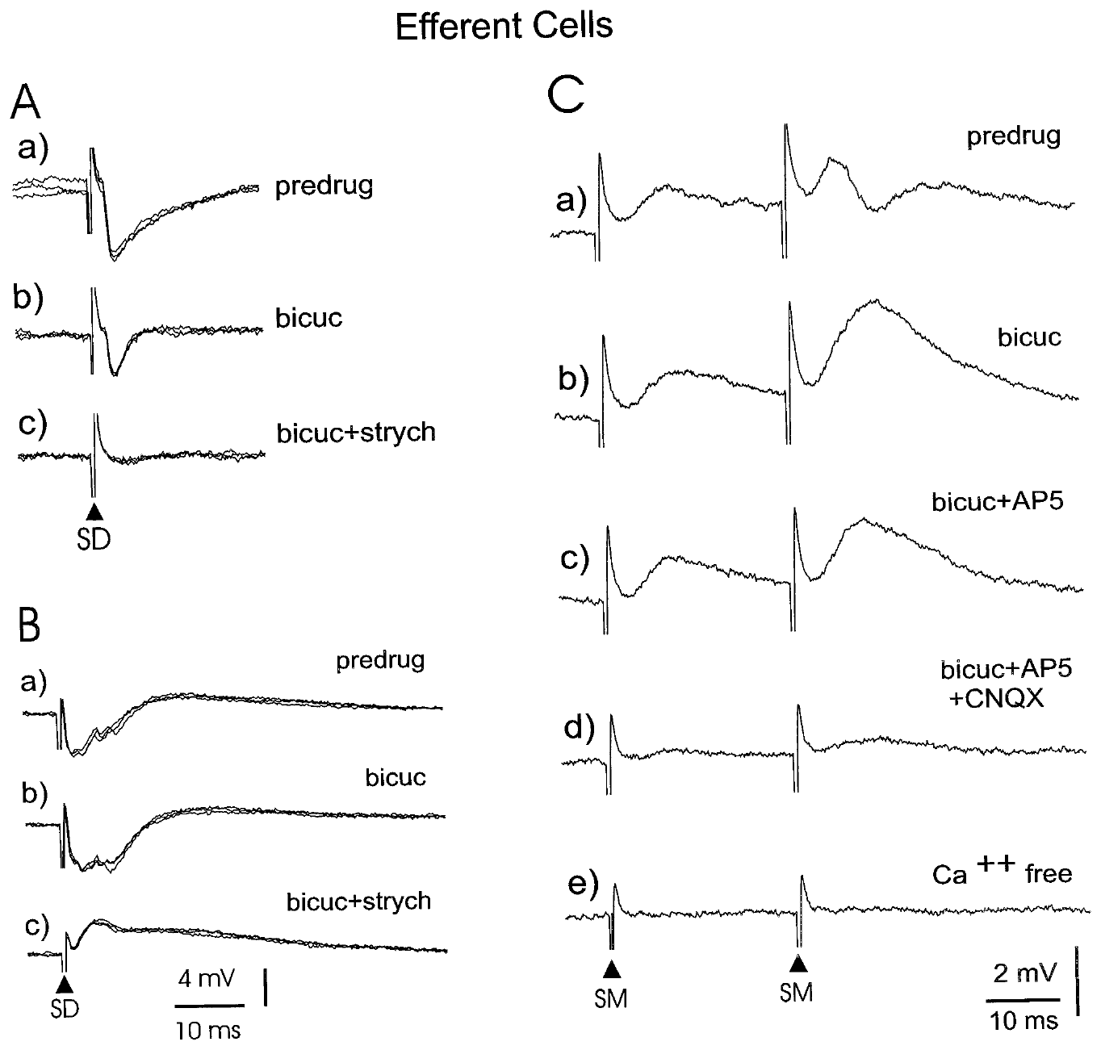
GABA and glycine contribute to deep-input inhibition
An inhibitory postsynaptic potential, or IPSP, is a synaptic response that reduces excitability under the recorded conditions. Grant and colleagues stimulated deep ELL pathways while recording identified output cells and used bicuculline and strychnine to test inhibitory receptor contributions.
Bicuculline blocks GABA-A receptors, while strychnine blocks glycine receptors. Sequential blockade reduced or abolished inhibitory responses, revealing that deep-input inhibition could involve both transmitter systems rather than one uniform inhibitory mechanism.
These ligand-gated receptors provide ionic conductances through which synaptic input changes membrane voltage. The results establish pharmacological contributions in the slice; they do not prove that every electrically recruited inhibitory connection is activated with the same strength during natural sensing.
Grant et al. (1998), Fig. 13(A–C). Inhibitory and excitatory responses in identified efferent cells.
Grant et al. (1998), Fig. 1. Locations of ELL input layers and efferent neurons.
Grant et al. (1998)
31
Notes:
• An inhibitory postsynaptic potential, or IPSP, is a synaptic response that reduces excitability under the recorded conditions. Grant and colleagues stimulated deep ELL pathways while recording identified output cells and used bicuculline and strychnine to test inhibitory receptor contributions.
• Bicuculline blocks GABA-A receptors, while strychnine blocks glycine receptors. Sequential blockade reduced or abolished inhibitory responses, revealing that deep-input inhibition could involve both transmitter systems rather than one uniform inhibitory mechanism.
• These ligand-gated receptors provide ionic conductances through which synaptic input changes membrane voltage. The results establish pharmacological contributions in the slice; they do not prove that every electrically recruited inhibitory connection is activated with the same strength during natural sensing.
• GABA is gamma-aminobutyric acid, an inhibitory transmitter in the studied circuit. Glycine supplies a distinct inhibitory receptor pathway that the second antagonist helps separate.
References:
K. Grant; Y. Sugawara; L. Gómez; V.Z. Han; C.C. Bell (1998). The Mormyrid Electrosensory Lobe In Vitro: Physiology and Pharmacology of Cells and Circuits. Journal of Neuroscience 18(15):6009–6025. https://doi.org/10.1523/JNEUROSCI.18-15-06009.1998
Figure: Grant et al. (1998), Fig. 13(A–C). Inhibitory and excitatory responses in identified efferent cells.
Figure source: https://doi.org/10.1523/JNEUROSCI.18-15-06009.1998
Figure: Grant et al. (1998), Fig. 1. Locations of ELL input layers and efferent neurons.
Figure source: https://doi.org/10.1523/JNEUROSCI.18-15-06009.1998

Slide 32
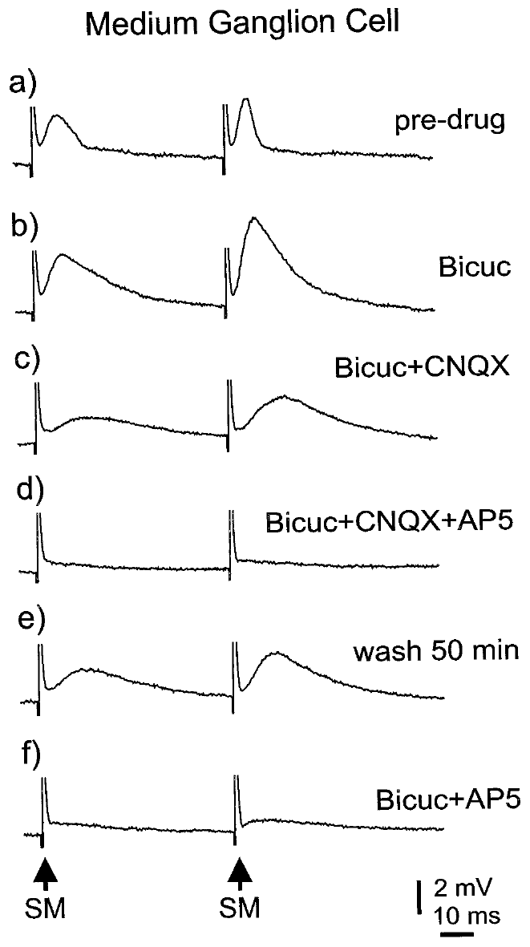
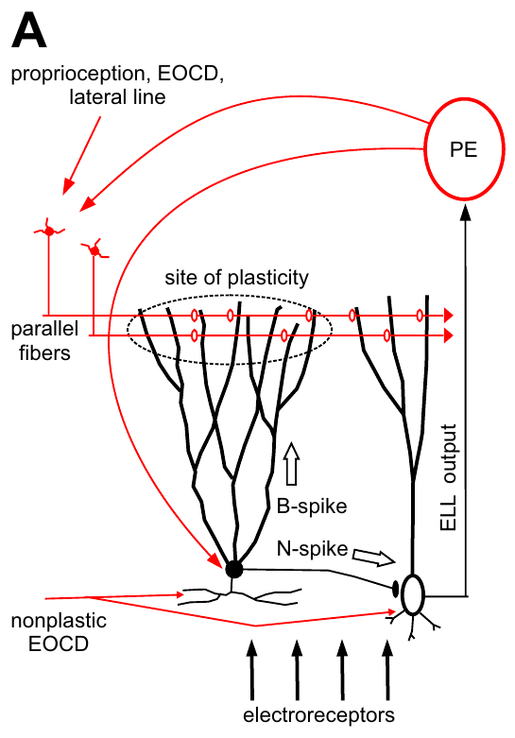
Parallel fibers evoke excitation followed by inhibition
A medium ganglion cell is a Purkinje-like ELL interneuron whose apical dendrites receive parallel-fiber input. Grant and colleagues stimulated those fibers and recorded a sequence of excitation followed by inhibition, then used antagonists to separate its components.
Bicuculline removed the inhibitory portion, while CNQX and AP-5 reduced glutamate-mediated excitation. Unlike inhibition recruited through deep inputs, the parallel-fiber-evoked inhibitory response was attributed to GABA-A receptors rather than a combined GABA-A and glycine contribution.
The ordering of excitation and inhibition shapes the interval during which synaptic drive can produce firing. This measured sequence supports pathway-specific integration, without establishing that the recorded interneuron independently computes an object’s identity, size, or distance.
Grant et al. (1998), Fig. 11(a–f). Pharmacology of parallel-fiber responses in a medium ganglion cell.
Sawtell et al. (2007), Fig. 1(A). Published anatomy of the medium ganglion cell circuit.
Grant et al. (1998)
32
Notes:
• A medium ganglion cell is a Purkinje-like ELL interneuron whose apical dendrites receive parallel-fiber input. Grant and colleagues stimulated those fibers and recorded a sequence of excitation followed by inhibition, then used antagonists to separate its components.
• Bicuculline removed the inhibitory portion, while CNQX and AP-5 reduced glutamate-mediated excitation. Unlike inhibition recruited through deep inputs, the parallel-fiber-evoked inhibitory response was attributed to GABA-A receptors rather than a combined GABA-A and glycine contribution.
• The ordering of excitation and inhibition shapes the interval during which synaptic drive can produce firing. This measured sequence supports pathway-specific integration, without establishing that the recorded interneuron independently computes an object’s identity, size, or distance.
• An interneuron influences local circuit activity rather than constituting the principal long-range sensory output. Purkinje-like describes the dendritic and circuit organization, not identity with a cerebellar Purkinje cell.
References:
K. Grant; Y. Sugawara; L. Gómez; V.Z. Han; C.C. Bell (1998). The Mormyrid Electrosensory Lobe In Vitro: Physiology and Pharmacology of Cells and Circuits. Journal of Neuroscience 18(15):6009–6025. https://doi.org/10.1523/JNEUROSCI.18-15-06009.1998
N.B. Sawtell; A. Williams; C.C. Bell (2007). Central Control of Dendritic Spikes Shapes the Responses of Purkinje-Like Cells through Spike Timing-Dependent Synaptic Plasticity. Journal of Neuroscience 27(7):1552–1565. https://doi.org/10.1523/JNEUROSCI.5302-06.2007
Figure: Grant et al. (1998), Fig. 11(a–f). Pharmacology of parallel-fiber responses in a medium ganglion cell.
Figure source: https://doi.org/10.1523/JNEUROSCI.18-15-06009.1998
Figure: Sawtell et al. (2007), Fig. 1(A). Published anatomy of the medium ganglion cell circuit.
Figure source: https://doi.org/10.1523/JNEUROSCI.5302-06.2007

Slide 33
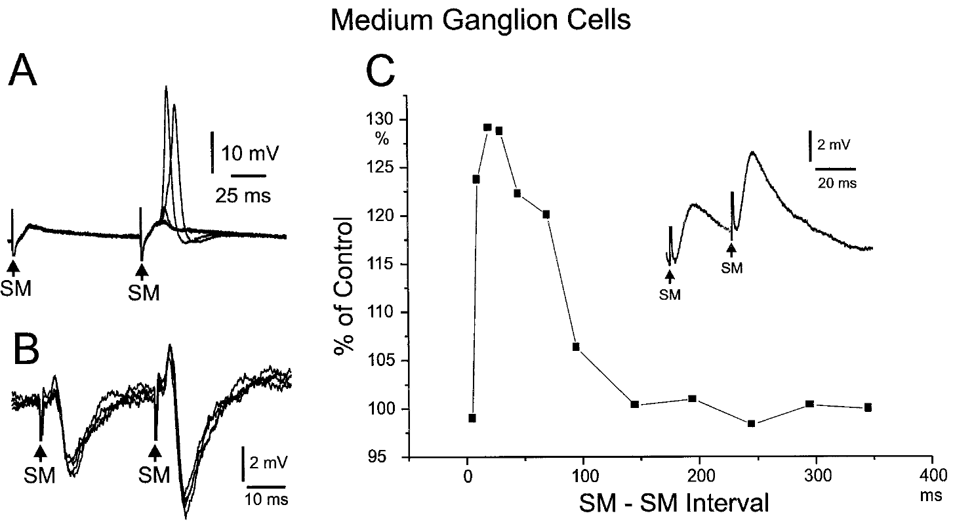
Paired pulses reveal history-dependent synaptic strength
Paired-pulse facilitation is an increase in the response to a second closely spaced stimulus. Grant and colleagues stimulated parallel fibers twice and recorded larger second EPSPs in medium ganglion cells, with facilitation depending on the spacing of the two pulses.
The experiment varied intervals across tens to hundreds of milliseconds; comparisons using independent stimulation sites distinguished repeated recruitment of the same fiber population from activation of another population. Strong facilitation occurred at short intervals, including approximately 30 ms.
The result establishes short-term dependence of synaptic efficacy on recent activity. It does not alone locate the change exclusively in transmitter release or receptor sensitivity, and it should be distinguished from longer-lasting plasticity driven by repeated spike-timing pairings.
Grant et al. (1998), Fig. 10(A–C). Parallel-fiber paired-pulse facilitation in medium ganglion cells.
Sawtell et al. (2007), Fig. 1(A). Published anatomy of the medium ganglion cell circuit.
Grant et al. (1998)
33
Notes:
• Paired-pulse facilitation is an increase in the response to a second closely spaced stimulus. Grant and colleagues stimulated parallel fibers twice and recorded larger second EPSPs in medium ganglion cells, with facilitation depending on the spacing of the two pulses.
• The experiment varied intervals across tens to hundreds of milliseconds; comparisons using independent stimulation sites distinguished repeated recruitment of the same fiber population from activation of another population. Strong facilitation occurred at short intervals, including approximately 30 ms.
• The result establishes short-term dependence of synaptic efficacy on recent activity. It does not alone locate the change exclusively in transmitter release or receptor sensitivity, and it should be distinguished from longer-lasting plasticity driven by repeated spike-timing pairings.
• Short-term facilitation modifies how a recent input affects the next response. It can shape temporal integration even before any durable learning-related change in synaptic strength is considered.
References:
K. Grant; Y. Sugawara; L. Gómez; V.Z. Han; C.C. Bell (1998). The Mormyrid Electrosensory Lobe In Vitro: Physiology and Pharmacology of Cells and Circuits. Journal of Neuroscience 18(15):6009–6025. https://doi.org/10.1523/JNEUROSCI.18-15-06009.1998
N.B. Sawtell; A. Williams; C.C. Bell (2007). Central Control of Dendritic Spikes Shapes the Responses of Purkinje-Like Cells through Spike Timing-Dependent Synaptic Plasticity. Journal of Neuroscience 27(7):1552–1565. https://doi.org/10.1523/JNEUROSCI.5302-06.2007
Figure: Grant et al. (1998), Fig. 10(A–C). Parallel-fiber paired-pulse facilitation in medium ganglion cells.
Figure source: https://doi.org/10.1523/JNEUROSCI.18-15-06009.1998
Figure: Sawtell et al. (2007), Fig. 1(A). Published anatomy of the medium ganglion cell circuit.
Figure source: https://doi.org/10.1523/JNEUROSCI.5302-06.2007

Slide 34
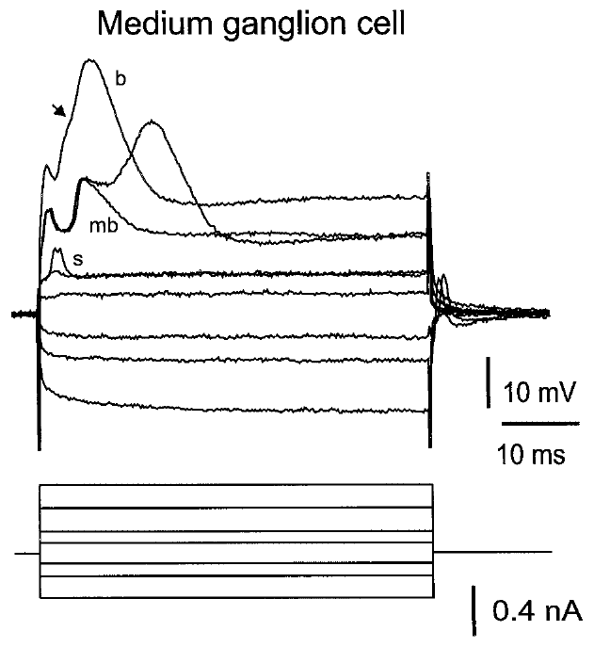
Medium ganglion cells generate distinct spike forms
An intrinsic response is generated by a cell’s membrane properties during controlled current injection. Grant and colleagues injected depolarizing and hyperpolarizing currents into medium ganglion cells and recorded a large broad spike together with smaller, narrower spikes.
The broad spikes had durations of approximately 8–15 ms and amplitudes of 40–60 mV in the intracellular recordings. Narrow spikes were approximately 1–2 ms wide, establishing that one identified cell could express distinct electrical events.
Waveform differences constrain possible propagation and integration mechanisms but do not independently assign a function. The slice study combined waveform measurements with field and pharmacological evidence; later in vivo experiments separately examined the relation of these spike types to circuit output and learning.
Grant et al. (1998), Fig. 8. Responses of an identified medium ganglion cell to current.
Sawtell et al. (2007), Fig. 1(A). Published anatomy of the medium ganglion cell circuit.
Grant et al. (1998)
34
Notes:
• An intrinsic response is generated by a cell’s membrane properties during controlled current injection. Grant and colleagues injected depolarizing and hyperpolarizing currents into medium ganglion cells and recorded a large broad spike together with smaller, narrower spikes.
• The broad spikes had durations of approximately 8–15 ms and amplitudes of 40–60 mV in the intracellular recordings. Narrow spikes were approximately 1–2 ms wide, establishing that one identified cell could express distinct electrical events.
• Waveform differences constrain possible propagation and integration mechanisms but do not independently assign a function. The slice study combined waveform measurements with field and pharmacological evidence; later in vivo experiments separately examined the relation of these spike types to circuit output and learning.
• Depolarizing current makes membrane voltage less negative, while hyperpolarizing current makes it more negative. Different spike forms can reflect distinct initiation and propagation compartments within a single cell.
References:
K. Grant; Y. Sugawara; L. Gómez; V.Z. Han; C.C. Bell (1998). The Mormyrid Electrosensory Lobe In Vitro: Physiology and Pharmacology of Cells and Circuits. Journal of Neuroscience 18(15):6009–6025. https://doi.org/10.1523/JNEUROSCI.18-15-06009.1998
N.B. Sawtell; A. Williams; C.C. Bell (2007). Central Control of Dendritic Spikes Shapes the Responses of Purkinje-Like Cells through Spike Timing-Dependent Synaptic Plasticity. Journal of Neuroscience 27(7):1552–1565. https://doi.org/10.1523/JNEUROSCI.5302-06.2007
Figure: Grant et al. (1998), Fig. 8. Responses of an identified medium ganglion cell to current.
Figure source: https://doi.org/10.1523/JNEUROSCI.18-15-06009.1998
Figure: Sawtell et al. (2007), Fig. 1(A). Published anatomy of the medium ganglion cell circuit.
Figure source: https://doi.org/10.1523/JNEUROSCI.5302-06.2007

Slide 35
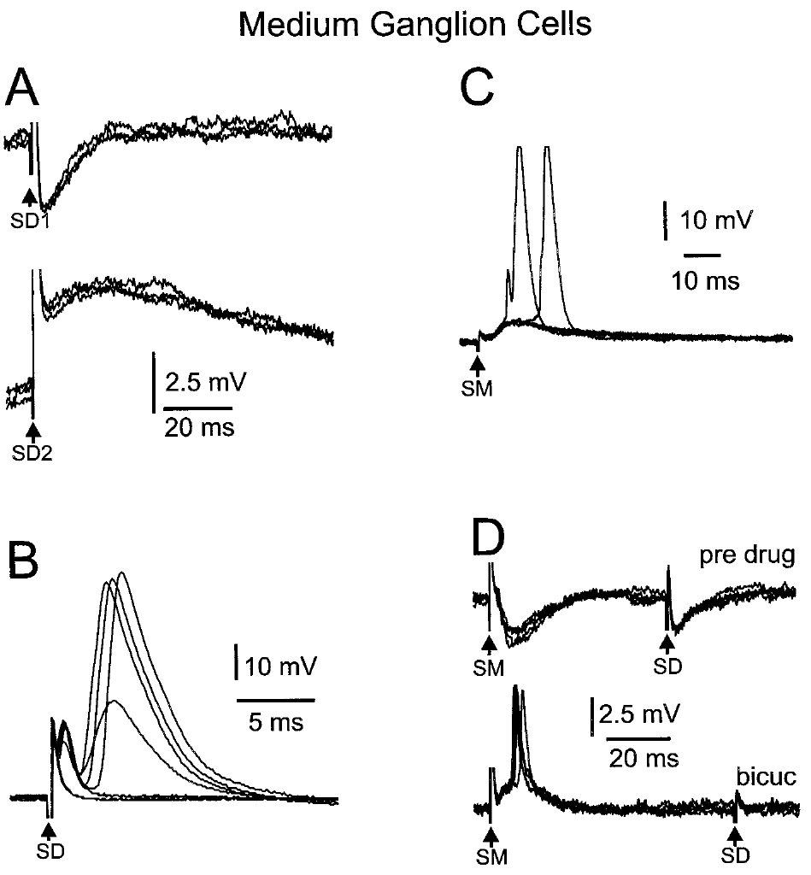
Synaptic pathway and spike threshold jointly shape firing
A spike threshold is the level of depolarizing drive needed to initiate a spike under specified conditions. Grant and colleagues stimulated deep pathways and parallel fibers while recording medium ganglion cells, comparing synaptic responses with the distinct spike forms of the same cell.
Deep stimulation could evoke inhibitory or excitatory potentials depending on stimulation position. Removing inhibition with bicuculline exposed broad-spike responses, while parallel-fiber stimulation could generate excitation and smaller spike events before stronger depolarization recruited broad spikes.
The results connect pathway recruitment to membrane excitability. They do not support assigning each stimulus electrode to one natural sensory feature; tract stimulation and pharmacological disinhibition alter the circuit conditions, and the observed firing reflects their combined influence on the recorded neuron.
Grant et al. (1998), Fig. 9(A–D). Medium ganglion responses to deep and molecular-layer stimuli.
Sawtell et al. (2007), Fig. 1(A). Published anatomy of the medium ganglion cell circuit.
Grant et al. (1998)
35
Notes:
• A spike threshold is the level of depolarizing drive needed to initiate a spike under specified conditions. Grant and colleagues stimulated deep pathways and parallel fibers while recording medium ganglion cells, comparing synaptic responses with the distinct spike forms of the same cell.
• Deep stimulation could evoke inhibitory or excitatory potentials depending on stimulation position. Removing inhibition with bicuculline exposed broad-spike responses, while parallel-fiber stimulation could generate excitation and smaller spike events before stronger depolarization recruited broad spikes.
• The results connect pathway recruitment to membrane excitability. They do not support assigning each stimulus electrode to one natural sensory feature; tract stimulation and pharmacological disinhibition alter the circuit conditions, and the observed firing reflects their combined influence on the recorded neuron.
• A threshold is conditional on membrane state and inhibition. Unmasking a spike with an antagonist does not mean the antagonist created a new pathway; it can reveal excitation that was already present.
References:
K. Grant; Y. Sugawara; L. Gómez; V.Z. Han; C.C. Bell (1998). The Mormyrid Electrosensory Lobe In Vitro: Physiology and Pharmacology of Cells and Circuits. Journal of Neuroscience 18(15):6009–6025. https://doi.org/10.1523/JNEUROSCI.18-15-06009.1998
N.B. Sawtell; A. Williams; C.C. Bell (2007). Central Control of Dendritic Spikes Shapes the Responses of Purkinje-Like Cells through Spike Timing-Dependent Synaptic Plasticity. Journal of Neuroscience 27(7):1552–1565. https://doi.org/10.1523/JNEUROSCI.5302-06.2007
Figure: Grant et al. (1998), Fig. 9(A–D). Medium ganglion responses to deep and molecular-layer stimuli.
Figure source: https://doi.org/10.1523/JNEUROSCI.18-15-06009.1998
Figure: Sawtell et al. (2007), Fig. 1(A). Published anatomy of the medium ganglion cell circuit.
Figure source: https://doi.org/10.1523/JNEUROSCI.5302-06.2007

Slide 36
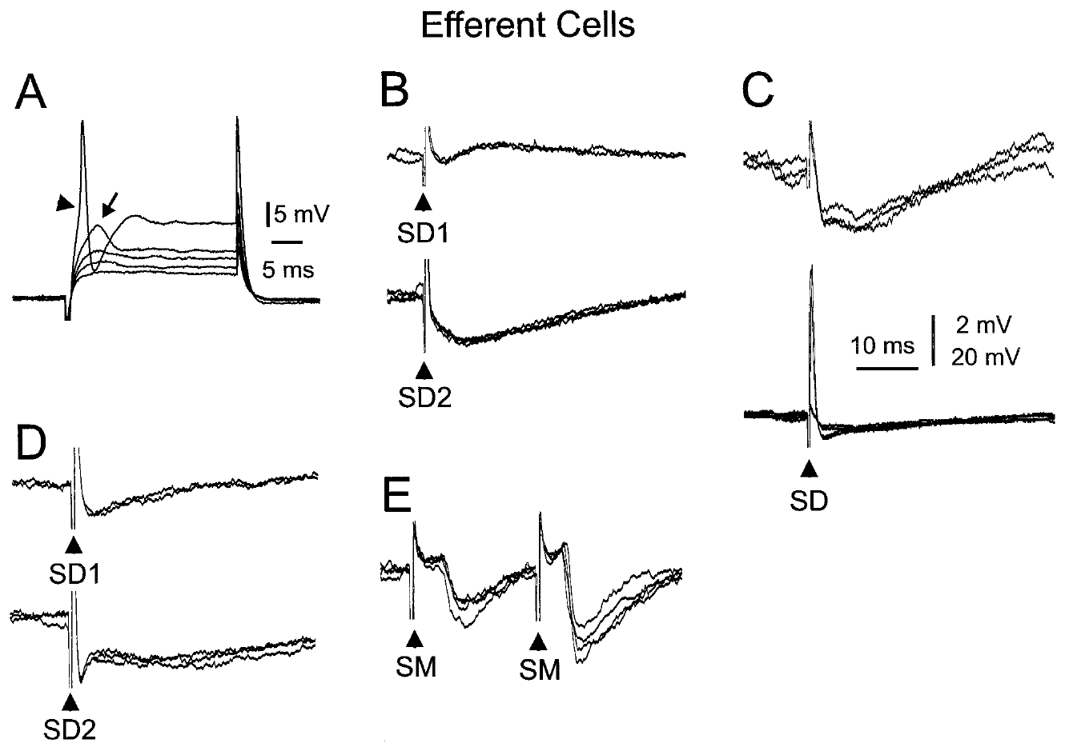
ELL output cells differ from local learning interneurons
An efferent cell is a neuron whose axon carries output away from the local sensory structure. Grant and colleagues recorded large ganglion and large fusiform cells, comparing their current-evoked firing and synaptic responses with those of medium ganglion interneurons.
The output cells responded to both deep-layer and molecular-layer stimulation, receiving excitatory and inhibitory influences whose balance depended on pathway and cell. These recordings place the medium ganglion cell’s local role within a circuit that also contains distinct sensory output neurons.
A local spike or synaptic potential is therefore not automatically the final signal delivered to downstream structures. The slice comparisons establish cellular and pathway diversity, while behavior-specific interpretation requires measurements linking output activity to controlled object stimuli in the intact animal.
Grant et al. (1998), Fig. 12(A–E). Current and synaptic responses of identified efferent cells.
Grant et al. (1998), Fig. 1. Anatomical organization of ELL cells and input layers.
Grant et al. (1998)
36
Notes:
• An efferent cell is a neuron whose axon carries output away from the local sensory structure. Grant and colleagues recorded large ganglion and large fusiform cells, comparing their current-evoked firing and synaptic responses with those of medium ganglion interneurons.
• The output cells responded to both deep-layer and molecular-layer stimulation, receiving excitatory and inhibitory influences whose balance depended on pathway and cell. These recordings place the medium ganglion cell’s local role within a circuit that also contains distinct sensory output neurons.
• A local spike or synaptic potential is therefore not automatically the final signal delivered to downstream structures. The slice comparisons establish cellular and pathway diversity, while behavior-specific interpretation requires measurements linking output activity to controlled object stimuli in the intact animal.
• A fusiform cell has an elongated cell body. Cell morphology and axonal role distinguish these recorded efferent neurons from the Purkinje-like medium ganglion interneuron.
References:
K. Grant; Y. Sugawara; L. Gómez; V.Z. Han; C.C. Bell (1998). The Mormyrid Electrosensory Lobe In Vitro: Physiology and Pharmacology of Cells and Circuits. Journal of Neuroscience 18(15):6009–6025. https://doi.org/10.1523/JNEUROSCI.18-15-06009.1998
Figure: Grant et al. (1998), Fig. 12(A–E). Current and synaptic responses of identified efferent cells.
Figure source: https://doi.org/10.1523/JNEUROSCI.18-15-06009.1998
Figure: Grant et al. (1998), Fig. 1. Anatomical organization of ELL cells and input layers.
Figure source: https://doi.org/10.1523/JNEUROSCI.18-15-06009.1998

Slide 37
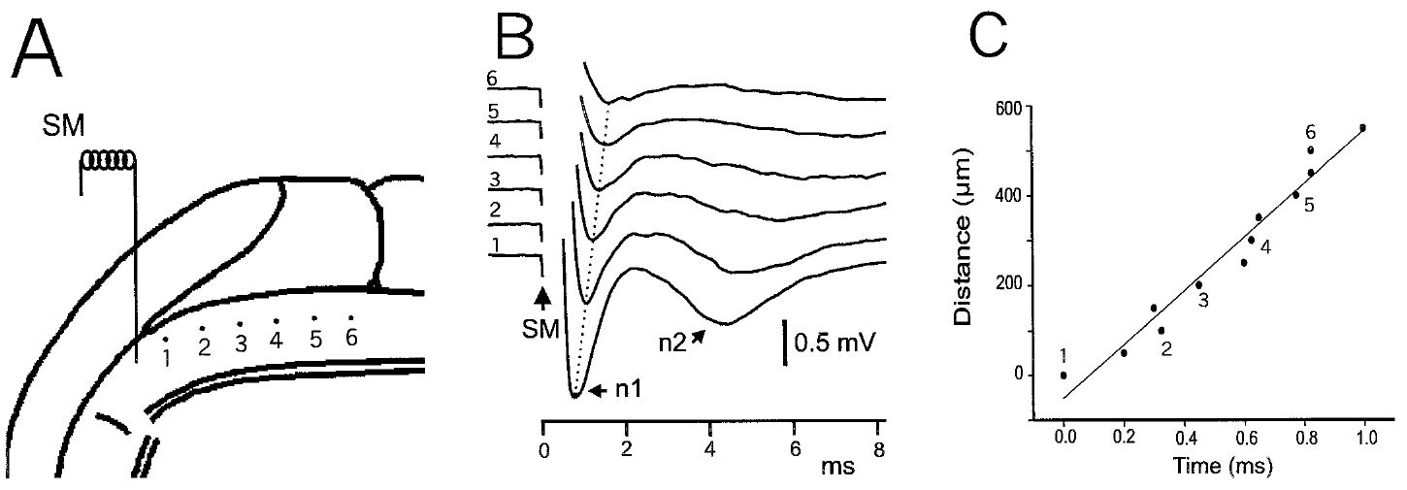
Parallel-fiber conduction distributes input through ELL
Conduction is propagation of an electrical signal along an axon. Grant and colleagues stimulated molecular-layer fibers and moved the recording site along the parallel-fiber beam, measuring how response latency changed with distance from the stimulation electrode.
Latency increased with the separation between stimulation and recording positions. The distance–time relationship supported propagation along the stimulated pathway, rather than simultaneous activation of every measured location by a single local postsynaptic event.
Such spatially distributed input can reach dendrites across an organized sensory structure, but the conduction measurements do not reveal the information carried by every fiber. They establish a physical transmission property in the slice, while the sensory and motor context represented in vivo must be determined separately.
Grant et al. (1998), Fig. 5(A–C). Field recordings along a stimulated parallel-fiber beam.
Grant et al. (1998), Fig. 1. ELL geometry and molecular-layer stimulation sites.
Grant et al. (1998)
37
Notes:
• Conduction is propagation of an electrical signal along an axon. Grant and colleagues stimulated molecular-layer fibers and moved the recording site along the parallel-fiber beam, measuring how response latency changed with distance from the stimulation electrode.
• Latency increased with the separation between stimulation and recording positions. The distance–time relationship supported propagation along the stimulated pathway, rather than simultaneous activation of every measured location by a single local postsynaptic event.
• Such spatially distributed input can reach dendrites across an organized sensory structure, but the conduction measurements do not reveal the information carried by every fiber. They establish a physical transmission property in the slice, while the sensory and motor context represented in vivo must be determined separately.
• The parallel-fiber beam is the aligned bundle recruited by molecular-layer stimulation. Measuring distance and arrival time tests propagation without assigning a perceptual meaning to the signal.
References:
K. Grant; Y. Sugawara; L. Gómez; V.Z. Han; C.C. Bell (1998). The Mormyrid Electrosensory Lobe In Vitro: Physiology and Pharmacology of Cells and Circuits. Journal of Neuroscience 18(15):6009–6025. https://doi.org/10.1523/JNEUROSCI.18-15-06009.1998
Figure: Grant et al. (1998), Fig. 5(A–C). Field recordings along a stimulated parallel-fiber beam.
Figure source: https://doi.org/10.1523/JNEUROSCI.18-15-06009.1998
Figure: Grant et al. (1998), Fig. 1. ELL geometry and molecular-layer stimulation sites.
Figure source: https://doi.org/10.1523/JNEUROSCI.18-15-06009.1998

Slide 38
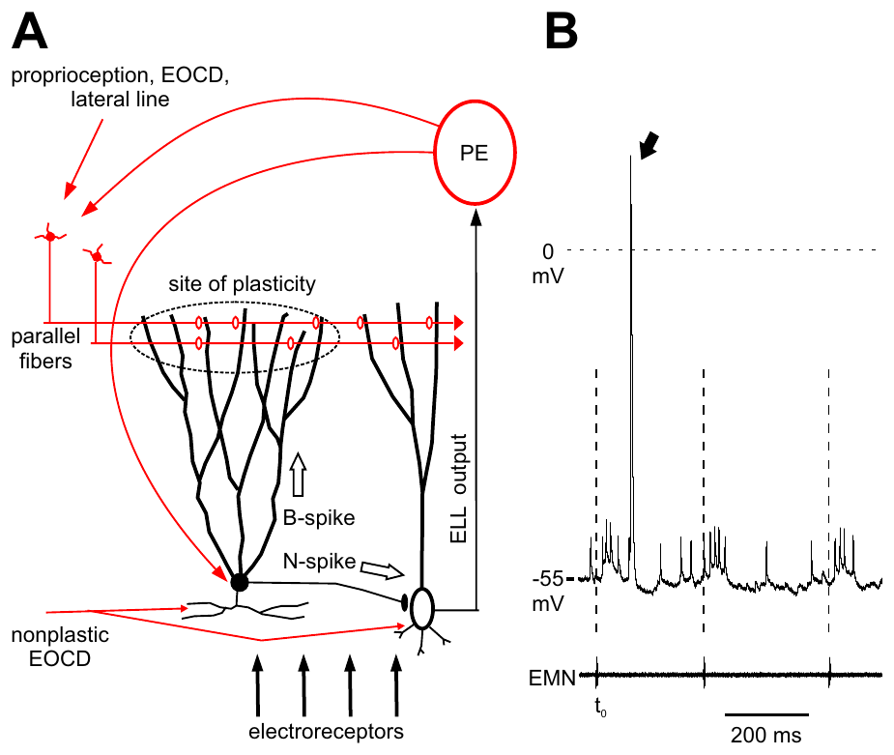
A motor command supplies context for sensory processing
A corollary discharge is an internal signal associated with a motor command. In mormyrid ELL, electric-organ command-related input accompanies peripheral electrosensory input, providing timing information about the animal’s own sensing action rather than only the external perturbation.
Sawtell and colleagues recorded medium ganglion cells in vivo and compared command-evoked activity, sensory responses, and broad versus narrow spikes. Their preparation separated the motor command signal from an experimentally delivered electric stimulus, allowing each contribution to be assessed.
The recordings support integration of self-generated context with sensory information. A corollary signal is not itself an electric image of an object, and a command-related response does not establish that the neuron encodes object shape or distance.
Sawtell et al. (2007), Fig. 1(A–B). Published circuit anatomy and command-linked cell responses.
Sawtell et al. (2007)
38
Notes:
• A corollary discharge is an internal signal associated with a motor command. In mormyrid ELL, electric-organ command-related input accompanies peripheral electrosensory input, providing timing information about the animal’s own sensing action rather than only the external perturbation.
• Sawtell and colleagues recorded medium ganglion cells in vivo and compared command-evoked activity, sensory responses, and broad versus narrow spikes. Their preparation separated the motor command signal from an experimentally delivered electric stimulus, allowing each contribution to be assessed.
• The recordings support integration of self-generated context with sensory information. A corollary signal is not itself an electric image of an object, and a command-related response does not establish that the neuron encodes object shape or distance.
• The corollary signal follows the command pathway even when the experimental preparation prevents the usual movement or electric emission. This permits a controlled comparison with separately supplied sensory stimulation.
References:
N.B. Sawtell; A. Williams; C.C. Bell (2007). Central Control of Dendritic Spikes Shapes the Responses of Purkinje-Like Cells through Spike Timing-Dependent Synaptic Plasticity. Journal of Neuroscience 27(7):1552–1565. https://doi.org/10.1523/JNEUROSCI.5302-06.2007
Figure: Sawtell et al. (2007), Fig. 1(A–B). Published circuit anatomy and command-linked cell responses.
Figure source: https://doi.org/10.1523/JNEUROSCI.5302-06.2007

Slide 39
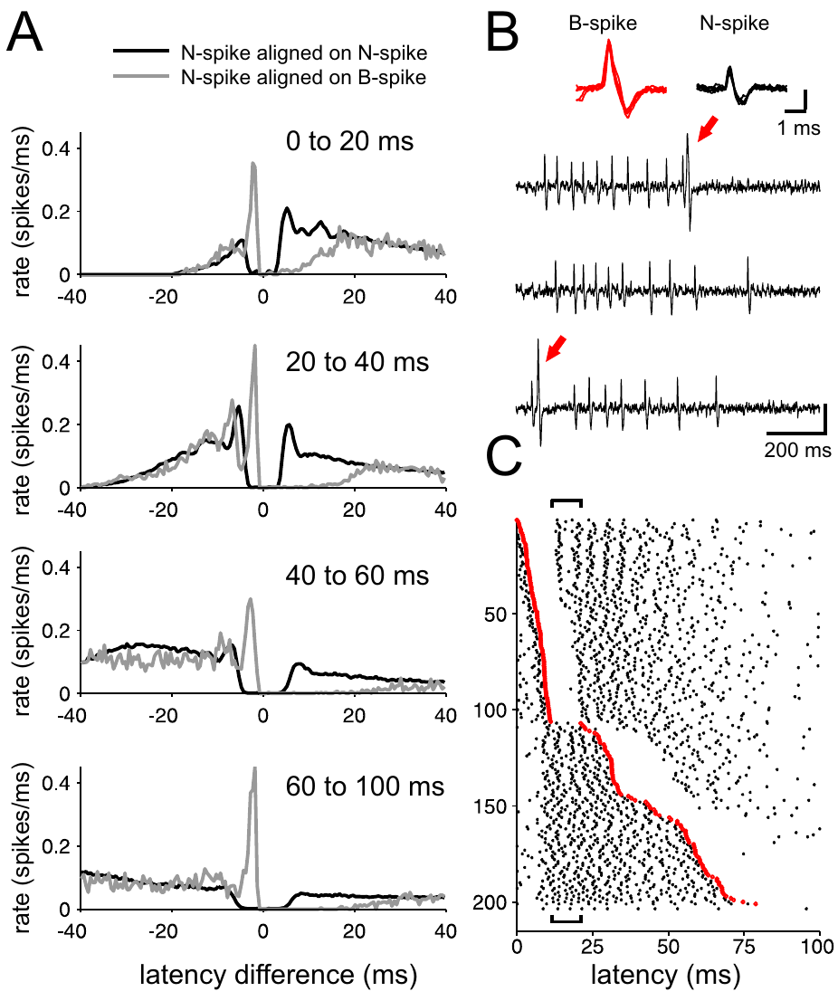
Broad and narrow spikes have different circuit roles
N spikes are narrow axonal spikes forming the principal medium ganglion output, whereas B spikes are broad dendritic events associated with parallel-fiber plasticity. Sawtell and colleagues recorded both event types to determine how one cell’s output and learning-related signals interact.
B spikes were associated with distinct patterns of nearby N spikes, and their timing varied within the electric-organ command cycle. The relationship established that the two event types can interact while remaining distinguishable in the same recordings.
The circuit interpretation separates immediate output from an event that regulates subsequent synaptic change. It does not mean every broad spike is a behavioral error signal, and waveform-based identification is supported by the anatomical and physiological context of the preparation.
Sawtell et al. (2007), Fig. 2(A–C). Broad-spike events and neighboring narrow-spike patterns.
Sawtell et al. (2007), Fig. 1(A). Published anatomy of the medium ganglion cell circuit.
Sawtell et al. (2007)
39
Notes:
• N spikes are narrow axonal spikes forming the principal medium ganglion output, whereas B spikes are broad dendritic events associated with parallel-fiber plasticity. Sawtell and colleagues recorded both event types to determine how one cell’s output and learning-related signals interact.
• B spikes were associated with distinct patterns of nearby N spikes, and their timing varied within the electric-organ command cycle. The relationship established that the two event types can interact while remaining distinguishable in the same recordings.
• The circuit interpretation separates immediate output from an event that regulates subsequent synaptic change. It does not mean every broad spike is a behavioral error signal, and waveform-based identification is supported by the anatomical and physiological context of the preparation.
• An axonal event travels along the output pathway; a dendritic event changes activity in the input-receiving compartment. Distinguishing them avoids equating all spikes in one neuron with the same functional signal.
References:
N.B. Sawtell; A. Williams; C.C. Bell (2007). Central Control of Dendritic Spikes Shapes the Responses of Purkinje-Like Cells through Spike Timing-Dependent Synaptic Plasticity. Journal of Neuroscience 27(7):1552–1565. https://doi.org/10.1523/JNEUROSCI.5302-06.2007
Figure: Sawtell et al. (2007), Fig. 2(A–C). Broad-spike events and neighboring narrow-spike patterns.
Figure source: https://doi.org/10.1523/JNEUROSCI.5302-06.2007
Figure: Sawtell et al. (2007), Fig. 1(A). Published anatomy of the medium ganglion cell circuit.
Figure source: https://doi.org/10.1523/JNEUROSCI.5302-06.2007

Slide 40
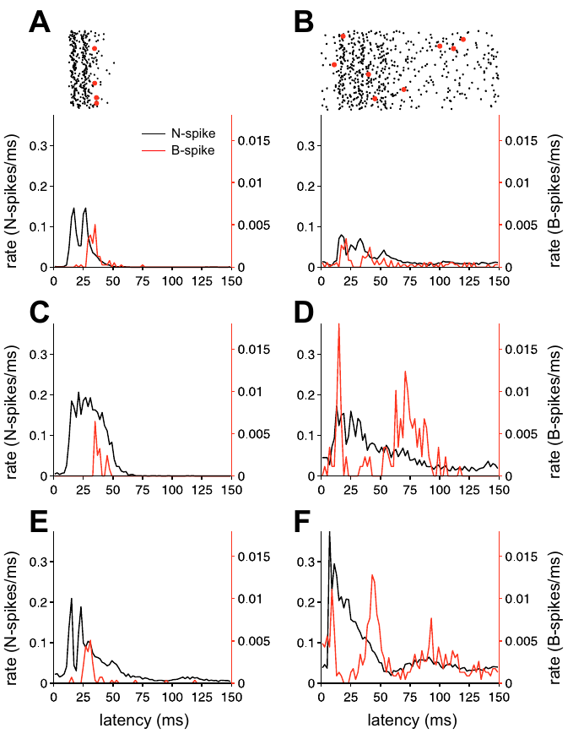
Command timing can dissociate excitation and B spikes
A command cycle is the interval following one electric-organ motor command. Sawtell and colleagues aligned medium ganglion recordings to that command and compared the time courses of narrow-spike output with broad-spike probability.
B-spike probability could fall during an interval approximately 10–20 ms after the command even while N-spike output was elevated. The different time courses indicated that increased output did not require a matching increase in the learning-related dendritic event.
The dissociation supports control at distinct compartments or input pathways rather than one scalar excitability change affecting every spike equally. The recordings establish temporal relationships; pharmacological manipulation and conductance measurements supplied additional evidence about the inhibitory mechanism.
Sawtell et al. (2007), Fig. 3(A–F). Command-evoked patterns of narrow and broad spikes.
Sawtell et al. (2007), Fig. 1(A). Published anatomy of the medium ganglion cell circuit.
Sawtell et al. (2007)
40
Notes:
• A command cycle is the interval following one electric-organ motor command. Sawtell and colleagues aligned medium ganglion recordings to that command and compared the time courses of narrow-spike output with broad-spike probability.
• B-spike probability could fall during an interval approximately 10–20 ms after the command even while N-spike output was elevated. The different time courses indicated that increased output did not require a matching increase in the learning-related dendritic event.
• The dissociation supports control at distinct compartments or input pathways rather than one scalar excitability change affecting every spike equally. The recordings establish temporal relationships; pharmacological manipulation and conductance measurements supplied additional evidence about the inhibitory mechanism.
• Command alignment compares repeated trials on a common temporal reference. A pause in one spike class during a burst in another constrains how inhibition can act on the cell.
References:
N.B. Sawtell; A. Williams; C.C. Bell (2007). Central Control of Dendritic Spikes Shapes the Responses of Purkinje-Like Cells through Spike Timing-Dependent Synaptic Plasticity. Journal of Neuroscience 27(7):1552–1565. https://doi.org/10.1523/JNEUROSCI.5302-06.2007
Figure: Sawtell et al. (2007), Fig. 3(A–F). Command-evoked patterns of narrow and broad spikes.
Figure source: https://doi.org/10.1523/JNEUROSCI.5302-06.2007
Figure: Sawtell et al. (2007), Fig. 1(A). Published anatomy of the medium ganglion cell circuit.
Figure source: https://doi.org/10.1523/JNEUROSCI.5302-06.2007

Slide 41
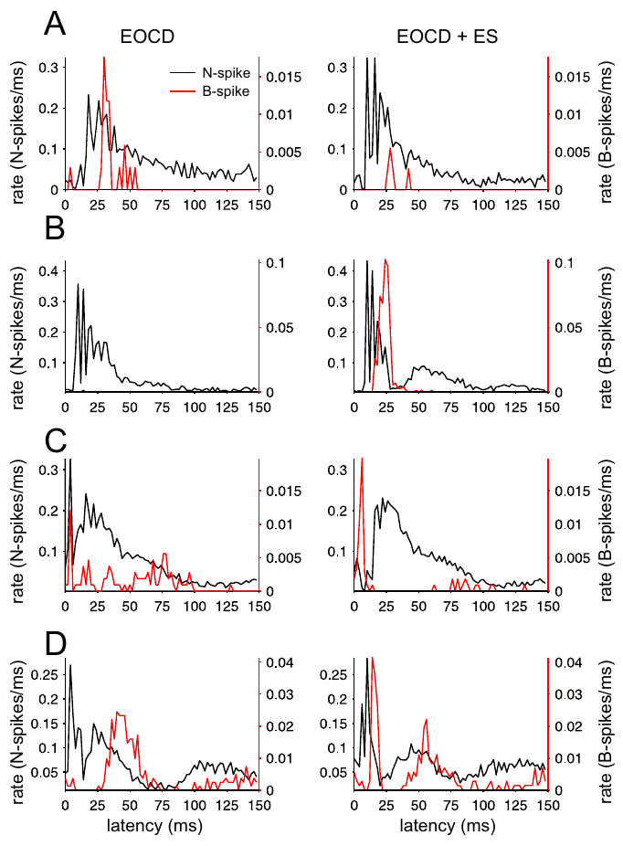
Electrosensory stimuli affect the two spike types unequally
A compartment-specific response is a change that differs across a neuron’s axonal and dendritic events. Sawtell and colleagues varied electrosensory stimuli while recording N spikes and B spikes in medium ganglion cells, holding the command reference available for comparison.
Some stimuli increased N spikes while decreasing B spikes, and other conditions produced the opposite pattern. Thus, sensory excitation and learning-related dendritic firing could not be summarized reliably by one pooled spike rate.
The result supports functional separation within the recorded cell. It does not establish that the cell has independent perceptual decisions in its compartments; the compartments participate in one circuit, with output and plasticity influenced differently by incoming sensory and central signals.
Sawtell et al. (2007), Fig. 4(A–D). Narrow and broad responses to controlled electrosensory stimuli.
Sawtell et al. (2007), Fig. 1(A). Published anatomy of the medium ganglion cell circuit.
Sawtell et al. (2007)
41
Notes:
• A compartment-specific response is a change that differs across a neuron’s axonal and dendritic events. Sawtell and colleagues varied electrosensory stimuli while recording N spikes and B spikes in medium ganglion cells, holding the command reference available for comparison.
• Some stimuli increased N spikes while decreasing B spikes, and other conditions produced the opposite pattern. Thus, sensory excitation and learning-related dendritic firing could not be summarized reliably by one pooled spike rate.
• The result supports functional separation within the recorded cell. It does not establish that the cell has independent perceptual decisions in its compartments; the compartments participate in one circuit, with output and plasticity influenced differently by incoming sensory and central signals.
• Pooling broad and narrow events would conceal changes in opposite directions. Their separate classification preserves information about how sensory input affects immediate output and the event associated with synaptic adaptation.
References:
N.B. Sawtell; A. Williams; C.C. Bell (2007). Central Control of Dendritic Spikes Shapes the Responses of Purkinje-Like Cells through Spike Timing-Dependent Synaptic Plasticity. Journal of Neuroscience 27(7):1552–1565. https://doi.org/10.1523/JNEUROSCI.5302-06.2007
Figure: Sawtell et al. (2007), Fig. 4(A–D). Narrow and broad responses to controlled electrosensory stimuli.
Figure source: https://doi.org/10.1523/JNEUROSCI.5302-06.2007
Figure: Sawtell et al. (2007), Fig. 1(A). Published anatomy of the medium ganglion cell circuit.
Figure source: https://doi.org/10.1523/JNEUROSCI.5302-06.2007

Slide 42
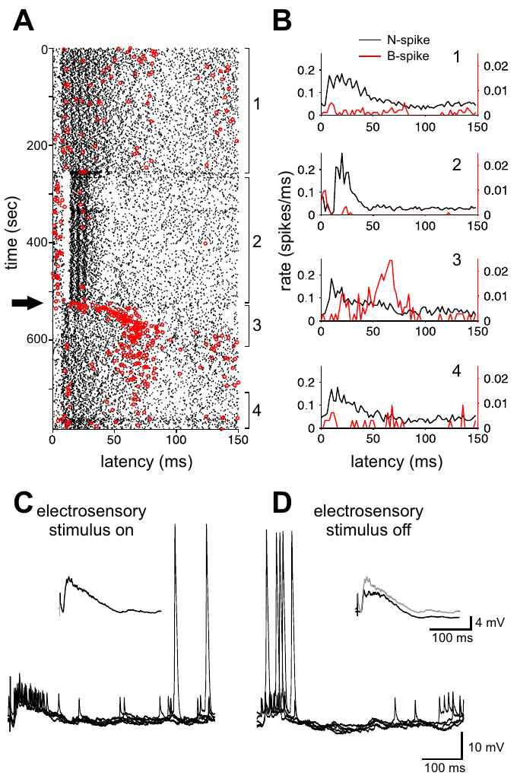
Recent stimulation changes command-linked B spikes
Recent context includes the stimulus sequence experienced before the currently measured command. Sawtell and colleagues examined B-spike responses during and after repeated electrosensory stimulation, distinguishing immediate stimulus effects from changes that persisted into subsequent command cycles.
The history of stimulation altered the probability and timing of B spikes. In some conditions, switching off the electrosensory stimulus produced a transient increase in early B-spike activity, even though the command signal remained the temporal reference.
The observation connects sensory history to the event controlling plasticity. It does not alone identify the responsible synapse or prove that every transient response is a learned prediction; additional inhibition and pairing experiments distinguish candidate mechanisms from the directly observed firing pattern.
Sawtell et al. (2007), Fig. 5(A–D). Broad-spike patterns before and after electrosensory stimulation.
Sawtell et al. (2007), Fig. 1(A). Published anatomy of the medium ganglion cell circuit.
Sawtell et al. (2007)
42
Notes:
• Recent context includes the stimulus sequence experienced before the currently measured command. Sawtell and colleagues examined B-spike responses during and after repeated electrosensory stimulation, distinguishing immediate stimulus effects from changes that persisted into subsequent command cycles.
• The history of stimulation altered the probability and timing of B spikes. In some conditions, switching off the electrosensory stimulus produced a transient increase in early B-spike activity, even though the command signal remained the temporal reference.
• The observation connects sensory history to the event controlling plasticity. It does not alone identify the responsible synapse or prove that every transient response is a learned prediction; additional inhibition and pairing experiments distinguish candidate mechanisms from the directly observed firing pattern.
• A response after stimulus removal can reflect the circuit state established during stimulation. The experiment measures that change in state without requiring the external stimulus to remain present.
References:
N.B. Sawtell; A. Williams; C.C. Bell (2007). Central Control of Dendritic Spikes Shapes the Responses of Purkinje-Like Cells through Spike Timing-Dependent Synaptic Plasticity. Journal of Neuroscience 27(7):1552–1565. https://doi.org/10.1523/JNEUROSCI.5302-06.2007
Figure: Sawtell et al. (2007), Fig. 5(A–D). Broad-spike patterns before and after electrosensory stimulation.
Figure source: https://doi.org/10.1523/JNEUROSCI.5302-06.2007
Figure: Sawtell et al. (2007), Fig. 1(A). Published anatomy of the medium ganglion cell circuit.
Figure source: https://doi.org/10.1523/JNEUROSCI.5302-06.2007

Slide 43
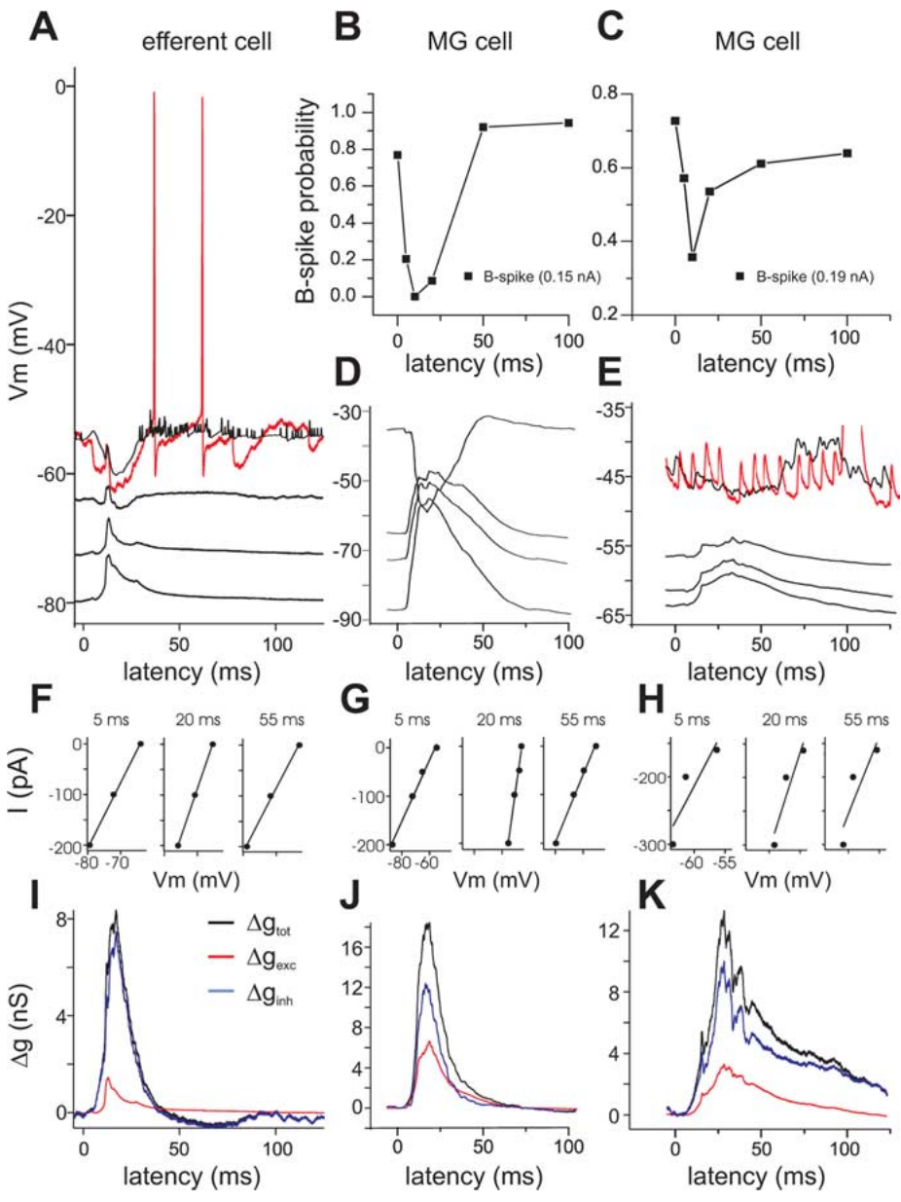
Command-evoked inhibition can coexist with excitation
A synaptic conductance is a change in membrane ion permeability produced by synaptic input. Sawtell and colleagues examined command-evoked membrane responses over different holding potentials, using their voltage dependence to separate excitatory and inhibitory contributions in ELL cells.
The recordings supported inhibition occurring during command-evoked excitation, including in medium ganglion cells. A reduced B-spike probability therefore did not require a complete absence of excitatory synaptic drive during that interval.
Concurrent inputs can affect dendritic firing and axonal output differently because their timing, location, and reversal properties differ. The conductance analysis constrains those contributions, but does not by itself identify every presynaptic inhibitory neuron or receptor distribution responsible for the intact command response.
Sawtell et al. (2007), Fig. 7(A–K). Conductance and voltage evidence for concurrent inhibition.
Sawtell et al. (2007), Fig. 1(A). Published anatomy of the medium ganglion cell circuit.
Sawtell et al. (2007)
43
Notes:
• A synaptic conductance is a change in membrane ion permeability produced by synaptic input. Sawtell and colleagues examined command-evoked membrane responses over different holding potentials, using their voltage dependence to separate excitatory and inhibitory contributions in ELL cells.
• The recordings supported inhibition occurring during command-evoked excitation, including in medium ganglion cells. A reduced B-spike probability therefore did not require a complete absence of excitatory synaptic drive during that interval.
• Concurrent inputs can affect dendritic firing and axonal output differently because their timing, location, and reversal properties differ. The conductance analysis constrains those contributions, but does not by itself identify every presynaptic inhibitory neuron or receptor distribution responsible for the intact command response.
• A holding potential is the membrane voltage imposed during the comparison. Changes in the response across holding potentials help distinguish synaptic currents with different reversal properties.
References:
N.B. Sawtell; A. Williams; C.C. Bell (2007). Central Control of Dendritic Spikes Shapes the Responses of Purkinje-Like Cells through Spike Timing-Dependent Synaptic Plasticity. Journal of Neuroscience 27(7):1552–1565. https://doi.org/10.1523/JNEUROSCI.5302-06.2007
Figure: Sawtell et al. (2007), Fig. 7(A–K). Conductance and voltage evidence for concurrent inhibition.
Figure source: https://doi.org/10.1523/JNEUROSCI.5302-06.2007
Figure: Sawtell et al. (2007), Fig. 1(A). Published anatomy of the medium ganglion cell circuit.
Figure source: https://doi.org/10.1523/JNEUROSCI.5302-06.2007

Slide 44
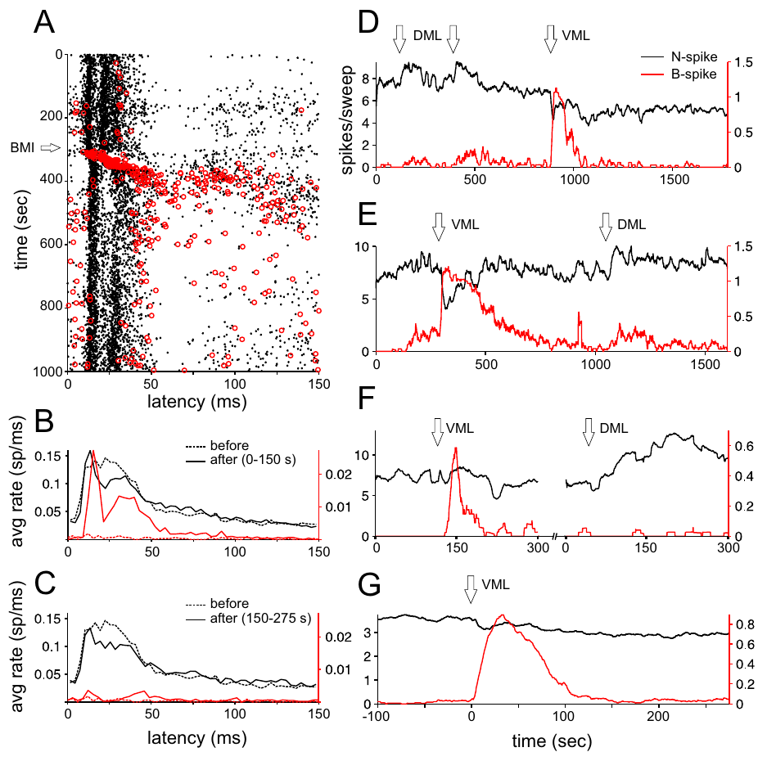
Blocking inhibition preferentially releases B spikes
Disinhibition is increased activity following removal of an inhibitory influence. Sawtell and colleagues injected bicuculline locally into the ventral molecular layer, blocking GABA-A receptor-mediated inhibition while recording command-linked medium ganglion spikes.
B-spike probability increased strongly just after the injection, with much less immediate change in N-spike output. More superficial injections had weaker effects on B spikes, supplying a spatial comparison rather than treating all local antagonist application as equivalent.
The manipulation supports a potent inhibitory control over dendritic events. It does not prove that inhibition only affects dendrites under every condition, and the injection changes a local network rather than selectively blocking one identified synapse. The observed selectivity is specific to the tested timing and locations.
Sawtell et al. (2007), Fig. 8(A–G). Effects of local bicuculline on narrow and broad spikes.
Sawtell et al. (2007), Fig. 1(A). Published anatomy of the medium ganglion cell circuit.
Sawtell et al. (2007)
44
Notes:
• Disinhibition is increased activity following removal of an inhibitory influence. Sawtell and colleagues injected bicuculline locally into the ventral molecular layer, blocking GABA-A receptor-mediated inhibition while recording command-linked medium ganglion spikes.
• B-spike probability increased strongly just after the injection, with much less immediate change in N-spike output. More superficial injections had weaker effects on B spikes, supplying a spatial comparison rather than treating all local antagonist application as equivalent.
• The manipulation supports a potent inhibitory control over dendritic events. It does not prove that inhibition only affects dendrites under every condition, and the injection changes a local network rather than selectively blocking one identified synapse. The observed selectivity is specific to the tested timing and locations.
• A local antagonist provides causal evidence that the blocked receptor pathway contributes to suppression. The deeper and more superficial injection comparisons constrain where the effective inhibitory influence is expressed.
References:
N.B. Sawtell; A. Williams; C.C. Bell (2007). Central Control of Dendritic Spikes Shapes the Responses of Purkinje-Like Cells through Spike Timing-Dependent Synaptic Plasticity. Journal of Neuroscience 27(7):1552–1565. https://doi.org/10.1523/JNEUROSCI.5302-06.2007
Figure: Sawtell et al. (2007), Fig. 8(A–G). Effects of local bicuculline on narrow and broad spikes.
Figure source: https://doi.org/10.1523/JNEUROSCI.5302-06.2007
Figure: Sawtell et al. (2007), Fig. 1(A). Published anatomy of the medium ganglion cell circuit.
Figure source: https://doi.org/10.1523/JNEUROSCI.5302-06.2007

Slide 45
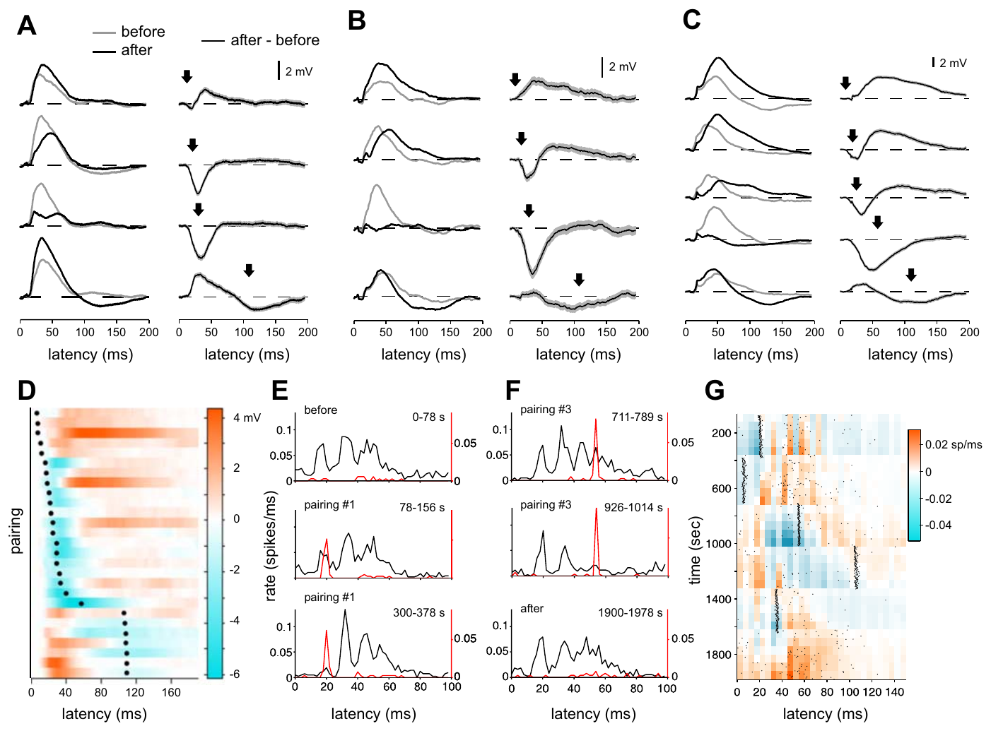
B-spike timing determines the direction of plasticity
Spike-timing-dependent plasticity is a lasting synaptic change whose direction depends on relative activity timing. Sawtell and colleagues repeatedly evoked a B spike at defined delays, approximately 8–110 ms after the electric-organ command, then compared command-evoked responses before and after pairing.
Pairing near the peak of the command response tended to reduce subsequent excitation, whereas earlier or later pairings could enhance it. Corresponding changes in N-spike output linked the altered synaptic response to the cell’s principal output event.
The results establish timing-dependent adaptation in the studied circuit. They do not directly demonstrate a complete object-recognition algorithm; they connect command context, dendritic events, synaptic strength, and axonal activity while leaving the transformation into a behavioral object judgment unresolved.
Sawtell et al. (2007), Fig. 9(A–G). Pairing effects on synaptic responses and narrow-spike output.
Sawtell et al. (2007), Fig. 1(A). Published anatomy of the medium ganglion cell circuit.
Sawtell et al. (2007)
45
Notes:
• Spike-timing-dependent plasticity is a lasting synaptic change whose direction depends on relative activity timing. Sawtell and colleagues repeatedly evoked a B spike at defined delays, approximately 8–110 ms after the electric-organ command, then compared command-evoked responses before and after pairing.
• Pairing near the peak of the command response tended to reduce subsequent excitation, whereas earlier or later pairings could enhance it. Corresponding changes in N-spike output linked the altered synaptic response to the cell’s principal output event.
• The results establish timing-dependent adaptation in the studied circuit. They do not directly demonstrate a complete object-recognition algorithm; they connect command context, dendritic events, synaptic strength, and axonal activity while leaving the transformation into a behavioral object judgment unresolved.
• Repeated pairing isolates the timing relationship experimentally. A change in output after pairing supports a functional consequence of synaptic adaptation, while the actual behavioral readout remains a separate level of evidence.
References:
N.B. Sawtell; A. Williams; C.C. Bell (2007). Central Control of Dendritic Spikes Shapes the Responses of Purkinje-Like Cells through Spike Timing-Dependent Synaptic Plasticity. Journal of Neuroscience 27(7):1552–1565. https://doi.org/10.1523/JNEUROSCI.5302-06.2007
Figure: Sawtell et al. (2007), Fig. 9(A–G). Pairing effects on synaptic responses and narrow-spike output.
Figure source: https://doi.org/10.1523/JNEUROSCI.5302-06.2007
Figure: Sawtell et al. (2007), Fig. 1(A). Published anatomy of the medium ganglion cell circuit.
Figure source: https://doi.org/10.1523/JNEUROSCI.5302-06.2007

Slide 46
Key takeaways
Active electrolocation samples self-generated fields. Object-induced current changes form electric images across the skin; recognition in darkness is a near-field capacity.
Object recognition can tolerate sensory transformations. Size constancy, rotation tolerance, and generalization depend on the tested geometry, distance, and learning conditions.
Movement creates additional distance information. Natural approaches shape sampling density and electrosensory flow; reconstructed relative gradients are candidate cues, not proven neural computations.
Afferent timing depends on sensory history. Local amplitude changes alter first-spike latency, but pulse intervals, baseline adaptation, and sensing rate also modify the code.
ELL integration is pathway and receptor specific. AMPA and NMDA receptors contribute excitation; GABA-A and glycine receptors contribute inhibition in pathway-dependent combinations.
Dendritic events regulate adaptation separately from output. Command-linked inhibition can suppress B spikes while N spikes persist; B-spike timing changes synaptic responses and subsequent output.
von der Emde et al. (2010); Hofmann et al. (2017); Schumacher et al. (2017); Sawtell et al. (2006); Grant et al. (1998); Sawtell et al. (2007)
46
Notes:
G. von der Emde; K. Behr; B. Bouton; J. Engelmann; S. Fetz; C. Folde (2010). 3-Dimensional scene perception during active electrolocation in a weakly electric pulse fish. Frontiers in Behavioral Neuroscience 4:26. https://doi.org/10.3389/fnbeh.2010.00026
V. Hofmann; J.I. Sanguinetti-Scheck; L. Gómez-Sena; J. Engelmann (2017). Sensory Flow as a Basis for a Novel Distance Cue in Freely Behaving Electric Fish. Journal of Neuroscience 37(2):302–312. https://doi.org/10.1523/JNEUROSCI.1361-16.2016
S. Schumacher; T. Burt de Perera; G. von der Emde (2017). Electrosensory capture during multisensory discrimination of nearby objects in the weakly electric fish Gnathonemus petersii. Scientific Reports 7:43665. https://doi.org/10.1038/srep43665
N.B. Sawtell; A. Williams; P.D. Roberts; G. von der Emde; C.C. Bell (2006). Effects of Sensing Behavior on a Latency Code. Journal of Neuroscience 26(32):8221–8234. https://doi.org/10.1523/JNEUROSCI.1508-06.2006
K. Grant; Y. Sugawara; L. Gómez; V.Z. Han; C.C. Bell (1998). The Mormyrid Electrosensory Lobe In Vitro: Physiology and Pharmacology of Cells and Circuits. Journal of Neuroscience 18(15):6009–6025. https://doi.org/10.1523/JNEUROSCI.18-15-06009.1998
N.B. Sawtell; A. Williams; C.C. Bell (2007). Central Control of Dendritic Spikes Shapes the Responses of Purkinje-Like Cells through Spike Timing-Dependent Synaptic Plasticity. Journal of Neuroscience 27(7):1552–1565. https://doi.org/10.1523/JNEUROSCI.5302-06.2007

