Slide 1
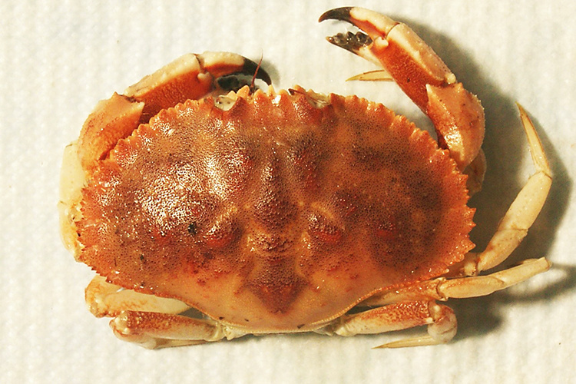
NEUR 411 · NEUROETHOLOGY · FALL 2026
Lecture 7
Central pattern generators II:
the lobster/crab stomatogastric ganglion (Marder & Selverston)
Wednesday, September 9, 2026
Jordan Lopez, Ph.D.
Professor of Neurobiology & Biomedical Engineering
Photo: Jonah crab (Cancer borealis). Courtesy NOAA Fisheries.
Notes:
Central pattern generators II: the lobster/crab stomatogastric ganglion (Marder & Selverston)
Lecture 7. NEUR 411 · NEUROETHOLOGY · FALL 2026. Wednesday, September 9, 2026.
Image: Photo: Jonah crab (Cancer borealis). Courtesy NOAA Fisheries. Credit: National Oceanic and Atmospheric Administration, NOAA Fisheries. License: U.S. government photograph; NOAA Fisheries permits reuse of NOAA-created photos with credit (https://www.fisheries.noaa.gov/disclaimer).. Source: https://www.fisheries.noaa.gov/species/jonah-crab

Slide 2
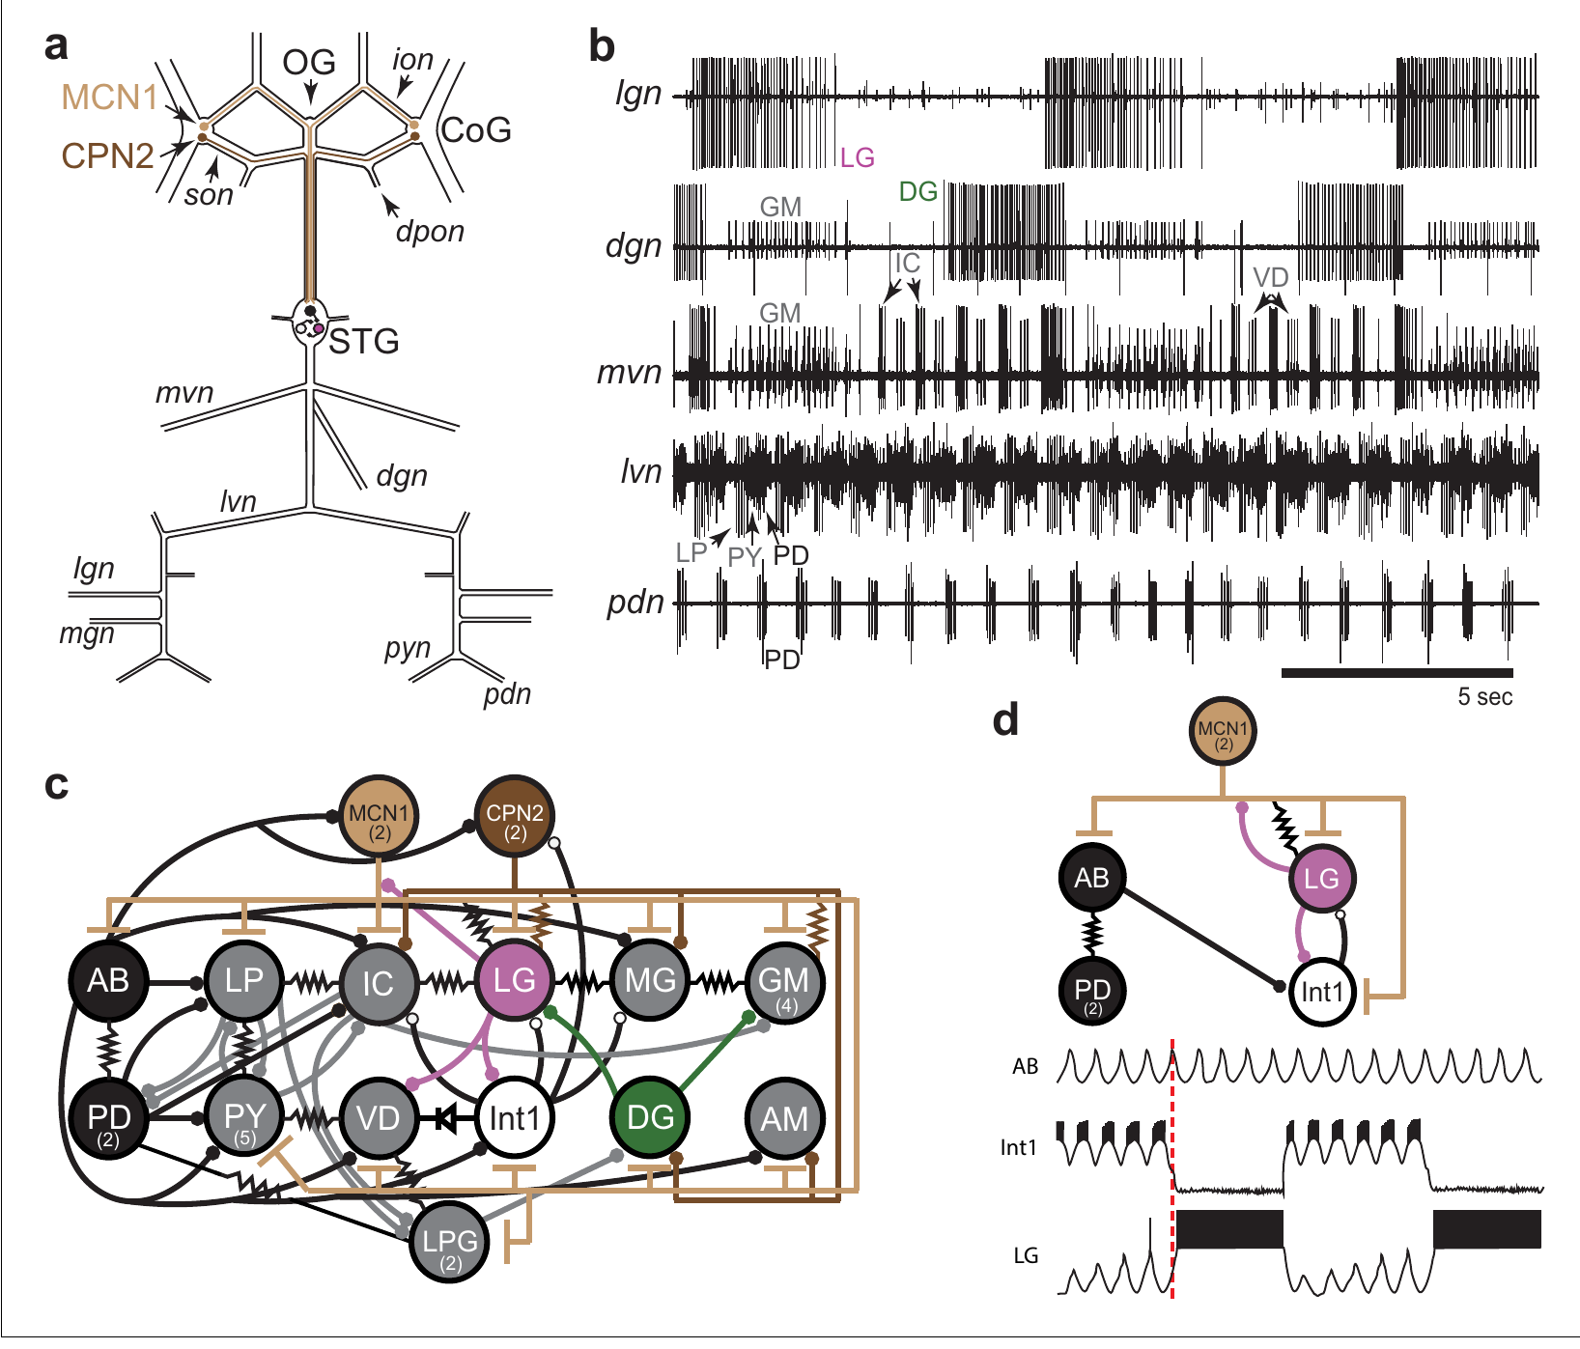
Two motor rhythms control processing in the foregut
The stomatogastric ganglion (STG) is a compact collection of neurons that controls movements of the crustacean foregut. In the Jonah crab, Cancer borealis, the gastric mill moves teeth used for chewing, whereas the pyloric system controls filtering. The two motor patterns operate on different timescales within the same ganglion.
Powell and colleagues recorded identified motor nerves simultaneously in an isolated nervous system. The pyloric rhythm was approximately 1 Hz, while the slower gastric mill rhythm was approximately 0.1 Hz. A burst is a group of action potentials separated from the next group by a quieter interval.
The preparation retains central circuitry but removes normal food movement and most peripheral feedback. Its recordings identify coordinated motor commands; they do not measure tooth forces, particle transport or the amount of food swallowed.
Powell et al. (2021), Fig. 1(a–d). STG anatomy, gastric and pyloric recordings and circuit connections
Powell et al. (2021); Garcia et al. (2015)
02
Notes:
• The stomatogastric ganglion (STG) is a compact collection of neurons that controls movements of the crustacean foregut. In the Jonah crab, Cancer borealis, the gastric mill moves teeth used for chewing, whereas the pyloric system controls filtering. The two motor patterns operate on different timescales within the same ganglion.
– The gastric mill and pyloric systems are motor systems inside the foregut, rather than two names for the same set of muscles.
• Powell and colleagues recorded identified motor nerves simultaneously in an isolated nervous system. The pyloric rhythm was approximately 1 Hz, while the slower gastric mill rhythm was approximately 0.1 Hz. A burst is a group of action potentials separated from the next group by a quieter interval.
– An action potential is a brief regenerative voltage change that travels along an axon; a nerve recording detects the spikes sent toward muscles.
• The preparation retains central circuitry but removes normal food movement and most peripheral feedback. Its recordings identify coordinated motor commands; they do not measure tooth forces, particle transport or the amount of food swallowed.
– A central pattern generator produces rhythmic neural output without requiring a separate sensory trigger for every cycle.
References:
Powell D, Haddad SA, Gorur-Shandilya S, Marder E. (2021). Coupling between fast and slow oscillator circuits in Cancer borealis is temperature-compensated. eLife 10: e60454. https://doi.org/10.7554/elife.60454
Garcia VJ, Daur N, Temporal S, Schulz DJ, Bucher D. (2015). Neuropeptide receptor transcript expression levels and magnitude of ionic current responses show cell type-specific differences in a small motor circuit. Journal of Neuroscience 35: 6786-6800. https://doi.org/10.1523/jneurosci.0171-15.2015
Figure: Powell et al. (2021), Fig. 1(a–d). STG anatomy, gastric and pyloric recordings and circuit connections
Figure source: https://doi.org/10.7554/elife.60454

Slide 3
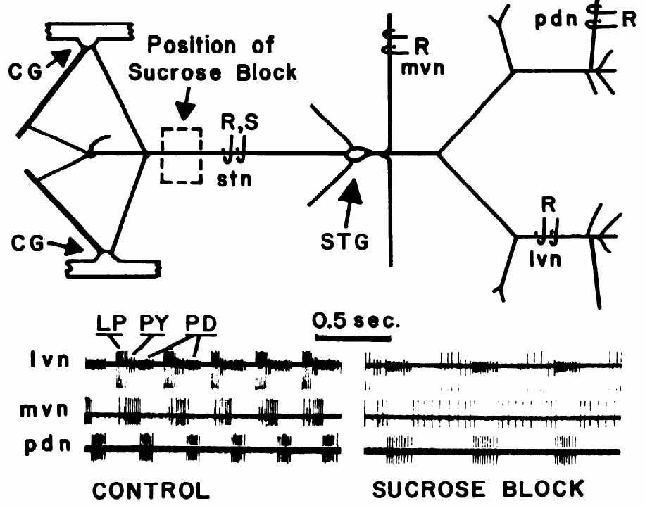
Input removal changes an isolated pyloric rhythm
Miller and Selverston isolated the stomatogastric nervous system of the spiny lobster, Panulirus interruptus. The STG remained connected to anterior ganglia through the stomatogastric nerve (stn). Electrodes on outgoing nerves detected the activity of motor neurons supplying the pyloric muscles.
An isotonic sucrose solution around a short segment of the stn reversibly blocked impulse conduction. Comparing the same preparation before and during the block separated the local circuit from ongoing input supplied by other ganglia. The published control and blocked records use a 0.5 s timescale.
Input blockade changed the pyloric motor pattern even though the local neurons and their connections remained present. Central rhythm generation therefore depends on circuit state as well as connectivity. A disconnected preparation cannot be treated as an unchanged copy of the intact animal.
Miller & Selverston (1982), Fig. 1. Dissected lobster nerves and motor activity with and without input
Miller & Selverston (1982)
03
Notes:
• Miller and Selverston isolated the stomatogastric nervous system of the spiny lobster, Panulirus interruptus. The STG remained connected to anterior ganglia through the stomatogastric nerve (stn). Electrodes on outgoing nerves detected the activity of motor neurons supplying the pyloric muscles.
– Isotonic means that the solution has an osmotic concentration suitable for the tissue; the local sucrose pool blocks conduction through the input nerve.
• An isotonic sucrose solution around a short segment of the stn reversibly blocked impulse conduction. Comparing the same preparation before and during the block separated the local circuit from ongoing input supplied by other ganglia. The published control and blocked records use a 0.5 s timescale.
– The control is the same nervous system before its descending input is blocked, so differences are not comparisons between different animals.
• Input blockade changed the pyloric motor pattern even though the local neurons and their connections remained present. Central rhythm generation therefore depends on circuit state as well as connectivity. A disconnected preparation cannot be treated as an unchanged copy of the intact animal.
– The experiment tests the contribution of input to the ganglion, without requiring the experimenter to remove each descending neuron individually.
References:
Miller JP, Selverston AI. (1982). Mechanisms underlying pattern generation in lobster stomatogastric ganglion as determined by selective inactivation of identified neurons. II. Oscillatory properties of pyloric neurons. Journal of Neurophysiology 48: 1378-1391. https://doi.org/10.1152/jn.1982.48.6.1378
Figure: Miller & Selverston (1982), Fig. 1. Dissected lobster nerves and motor activity with and without input
Figure source: https://doi.org/10.1152/jn.1982.48.6.1378

Slide 4
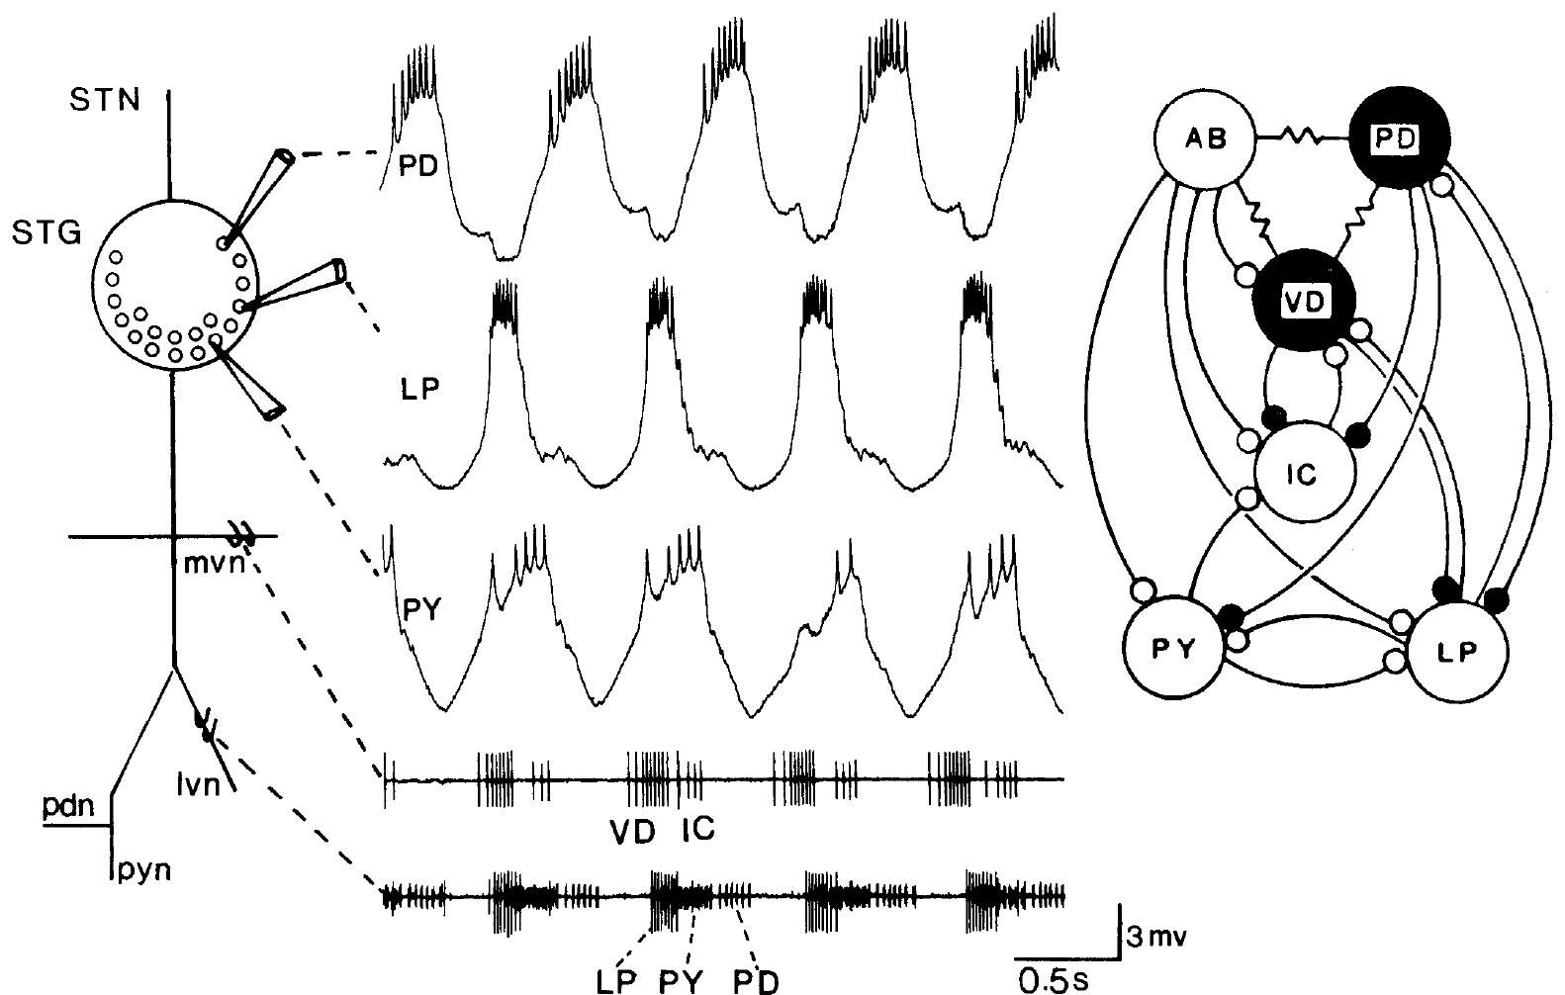
Identified motor neurons connect spikes to muscle output
Stomatogastric neurons can be identified by the muscles their axons innervate and by the nerves carrying those axons. The lobster ganglion contains about 30 neurons. The pyloric dilator (PD) neurons, lateral pyloric (LP) neuron and pyloric (PY) neurons form recognizable classes within its pyloric motor system.
Hooper and Marder combined intracellular recordings from neuron cell bodies with extracellular recordings from the lateral and median ventricular nerves. Intracellular recording measures membrane voltage through an electrode inside a cell; extracellular recording detects spikes outside cells, including spikes traveling along axons.
Matching a cell-body spike to a nerve spike establishes the recorded neuron’s output pathway. Its name identifies a motor role, but does not specify its intrinsic rhythm-generating ability, transmitter or response to a modulator. Those properties require separate physiological experiments.
Hooper & Marder (1987), Fig. 1. Lobster STG anatomy, identified recordings and pyloric connections
Hooper & Marder (1987); Rosenbaum & Marder (2018)
04
Notes:
• Stomatogastric neurons can be identified by the muscles their axons innervate and by the nerves carrying those axons. The lobster ganglion contains about 30 neurons. The pyloric dilator (PD) neurons, lateral pyloric (LP) neuron and pyloric (PY) neurons form recognizable classes within its pyloric motor system.
– A motor neuron sends its axon toward muscle; an interneuron communicates primarily with other neurons rather than directly innervating a muscle.
• Hooper and Marder combined intracellular recordings from neuron cell bodies with extracellular recordings from the lateral and median ventricular nerves. Intracellular recording measures membrane voltage through an electrode inside a cell; extracellular recording detects spikes outside cells, including spikes traveling along axons.
– The nerve records distinguish motor units by their characteristic spike patterns and correspondence with an intracellular recording.
• Matching a cell-body spike to a nerve spike establishes the recorded neuron’s output pathway. Its name identifies a motor role, but does not specify its intrinsic rhythm-generating ability, transmitter or response to a modulator. Those properties require separate physiological experiments.
– The count is species-dependent: the crab preparations studied by Rosenbaum and Marder contain 26–27 STG neurons, rather than the lobster count.
References:
Hooper SL, Marder E. (1987). Modulation of the lobster pyloric rhythm by the peptide proctolin. Journal of Neuroscience 7: 2097-2112. https://doi.org/10.1523/jneurosci.07-07-02097.1987
Rosenbaum P, Marder E. (2018). Graded Transmission without Action Potentials Sustains Rhythmic Activity in Some But Not All Modulators That Activate the Same Current. Journal of Neuroscience 38: 8976-8988. https://doi.org/10.1523/jneurosci.2632-17.2018
Figure: Hooper & Marder (1987), Fig. 1. Lobster STG anatomy, identified recordings and pyloric connections
Figure source: https://doi.org/10.1523/jneurosci.07-07-02097.1987

Slide 5
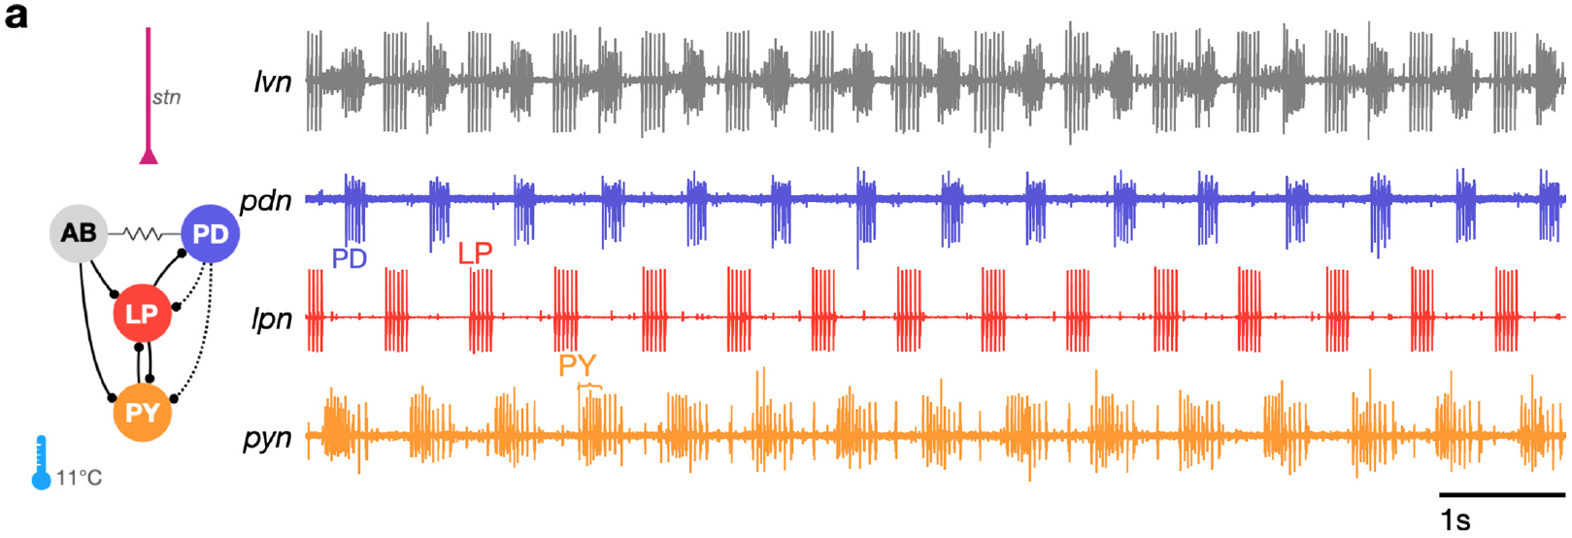
Crab pyloric output repeats in three ordered phases
The crab pyloric rhythm is triphasic: three neuron groups burst in a repeating sequence. PD activity is followed by LP activity and then PY activity. These motor commands activate different foregut muscles, organizing filtering movements rather than a synchronous contraction of the entire pyloric region.
Gorur-Shandilya and colleagues recorded separate PD, LP and PY motor nerves together with the mixed lateral ventricular nerve. The dedicated nerves separated units that overlapped in the mixed recording. Under baseline conditions at 11°C, the three groups retained their characteristic order on a 1 s timescale.
A mixed nerve signal can contain several identifiable neurons, but overlapping spikes become difficult to assign during irregular activity. Separate nerve recordings provide a control on unit identification. A regular sequence describes circuit output; it does not establish which neuron generates the rhythm.
Gorur-Shandilya et al. (2022), Fig. 1(a). Identified motor nerves resolve the regular crab pyloric rhythm
Gorur-Shandilya et al. (2022)
05
Notes:
• The crab pyloric rhythm is triphasic: three neuron groups burst in a repeating sequence. PD activity is followed by LP activity and then PY activity. These motor commands activate different foregut muscles, organizing filtering movements rather than a synchronous contraction of the entire pyloric region.
– The anterior burster, abbreviated AB, is an interneuron electrically coupled to the two PD motor neurons.
• Gorur-Shandilya and colleagues recorded separate PD, LP and PY motor nerves together with the mixed lateral ventricular nerve. The dedicated nerves separated units that overlapped in the mixed recording. Under baseline conditions at 11°C, the three groups retained their characteristic order on a 1 s timescale.
– An electrical synapse allows current to pass between coupled cells; a chemical synapse uses transmitter released by one cell to affect another.
• A mixed nerve signal can contain several identifiable neurons, but overlapping spikes become difficult to assign during irregular activity. Separate nerve recordings provide a control on unit identification. A regular sequence describes circuit output; it does not establish which neuron generates the rhythm.
– The dedicated pyloric dilator, lateral pyloric and pyloric nerves provide independent recordings of the motor groups.
References:
Gorur-Shandilya S, Cronin EM, Schneider AC, Haddad SA, Rosenbaum P, Bucher D, Nadim F, Marder E. (2022). Mapping circuit dynamics during function and dysfunction. eLife 11: e76579. https://doi.org/10.7554/elife.76579
Figure: Gorur-Shandilya et al. (2022), Fig. 1(a). Identified motor nerves resolve the regular crab pyloric rhythm
Figure source: https://doi.org/10.7554/elife.76579

Slide 6
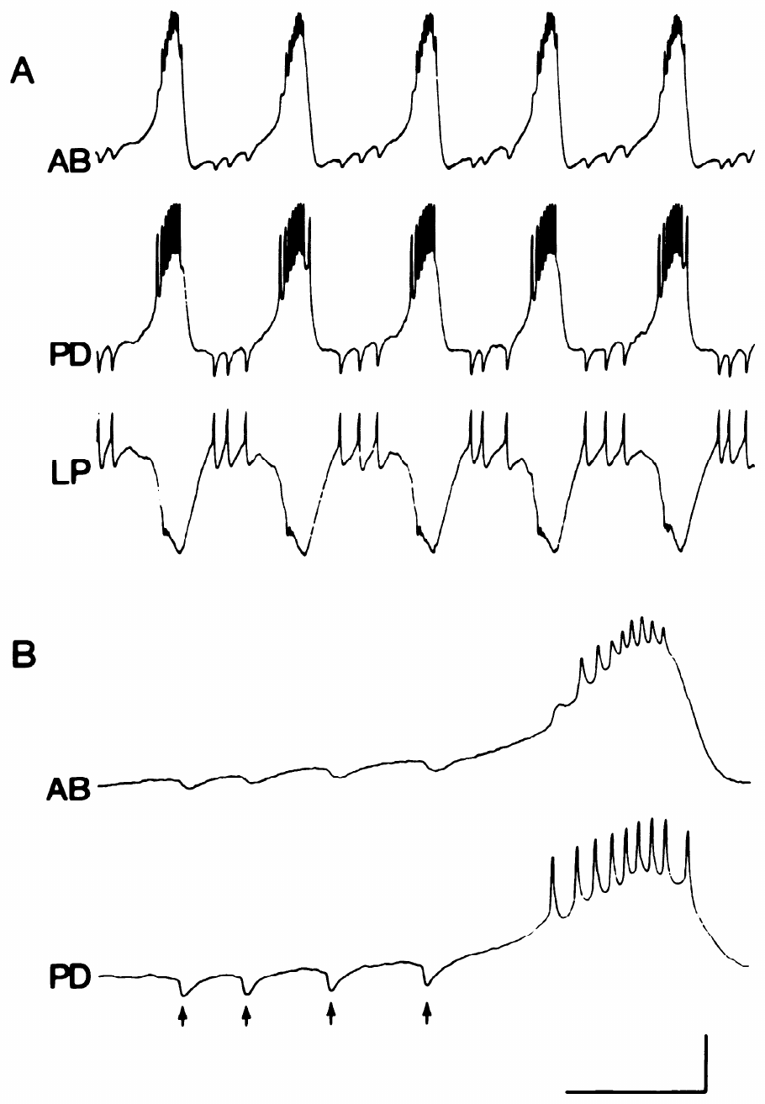
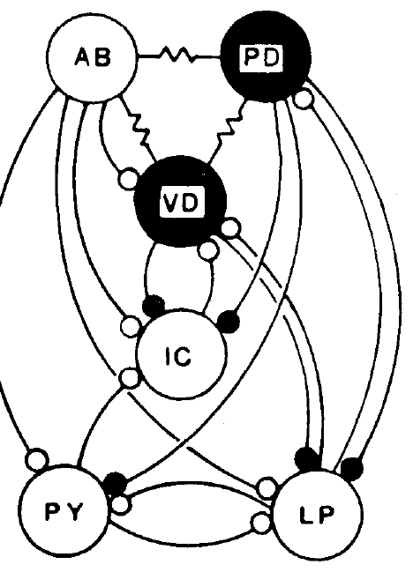
Electrical coupling synchronizes AB and PD activity
Eisen and Marder recorded the lobster anterior burster (AB) interneuron, a PD motor neuron and the LP motor neuron simultaneously. AB and PD underwent synchronous slow voltage oscillations, with spikes concentrated during their depolarized portions. Electrical coupling permits voltage changes in one cell to influence the other.
LP spikes were followed by inhibitory voltage changes in both PD and AB. An inhibitory postsynaptic potential (IPSP) is a synaptically produced voltage response that reduces the likelihood of firing under the tested conditions. In AB, these responses were smaller and slower than those recorded in PD.
The detailed recordings used calibrations of 4 mV and 0.5 s. A spike-associated response in a coupled cell can arrive indirectly through another neuron. Temporal association alone therefore does not establish a direct chemical synapse from LP to AB.
Hooper & Marder (1987), Fig. 1(right). Lobster pyloric circuit
Eisen & Marder (1982), Fig. 2(A–B). Synchronous AB–PD bursts and LP-evoked inhibitory potentials
Eisen & Marder (1982); Hooper & Marder (1987)
06
Notes:
• Eisen and Marder recorded the lobster anterior burster (AB) interneuron, a PD motor neuron and the LP motor neuron simultaneously. AB and PD underwent synchronous slow voltage oscillations, with spikes concentrated during their depolarized portions. Electrical coupling permits voltage changes in one cell to influence the other.
– The slow voltage wave is distinct from the individual action potentials riding on its depolarized portion.
• LP spikes were followed by inhibitory voltage changes in both PD and AB. An inhibitory postsynaptic potential (IPSP) is a synaptically produced voltage response that reduces the likelihood of firing under the tested conditions. In AB, these responses were smaller and slower than those recorded in PD.
– Electrical current spreading from PD could account for an inhibitory response in AB even if LP releases no transmitter directly onto AB.
• The detailed recordings used calibrations of 4 mV and 0.5 s. A spike-associated response in a coupled cell can arrive indirectly through another neuron. Temporal association alone therefore does not establish a direct chemical synapse from LP to AB.
– Selective deletion and independent current injection are needed to distinguish those alternative pathways.
References:
Eisen JS, Marder E. (1982). Mechanisms underlying pattern generation in lobster stomatogastric ganglion as determined by selective inactivation of identified neurons. III. Synaptic connections of electrically coupled pyloric neurons. Journal of Neurophysiology 48: 1392-1415. https://doi.org/10.1152/jn.1982.48.6.1392
Hooper SL, Marder E. (1987). Modulation of the lobster pyloric rhythm by the peptide proctolin. Journal of Neuroscience 7: 2097-2112. https://doi.org/10.1523/jneurosci.07-07-02097.1987
Figure: Eisen & Marder (1982), Fig. 2(A–B). Synchronous AB–PD bursts and LP-evoked inhibitory potentials
Figure source: https://doi.org/10.1152/jn.1982.48.6.1392
Figure: Hooper & Marder (1987), Fig. 1(right). Lobster pyloric circuit
Figure source: https://doi.org/10.1523/jneurosci.07-07-02097.1987

Slide 7
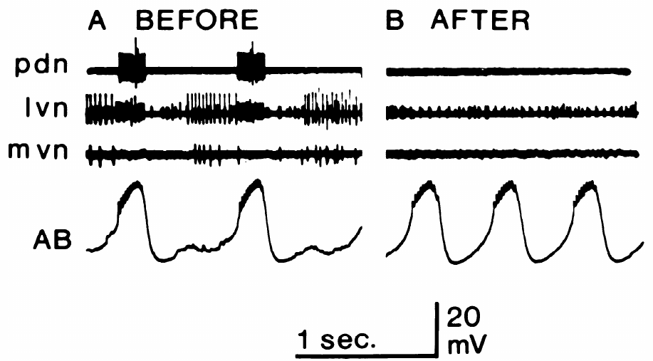
An isolated AB neuron retains endogenous bursting
Miller and Selverston tested whether a neuron could oscillate after its known synaptic inputs were removed. Photoinactivation used an intracellularly injected dye and illumination to disable selected cells. A sucrose block simultaneously removed impulse-mediated input through the stomatogastric nerve.
After PD, LP and ventricular dilator neurons were disabled, AB retained spontaneous slow oscillations. In the published before-and-after recordings, outgoing spikes from the deleted neurons disappeared while the intracellular AB oscillation remained. The voltage and time calibrations were 20 mV and 1 s.
An endogenous burster generates recurring depolarizations without the synaptic inputs tested in this isolation procedure. AB met that operational criterion. The experiment identifies a cell-level source of rhythmicity, while leaving the specific ionic mechanism of its oscillation unresolved.
Miller & Selverston (1982), Fig. 2(A–B). AB retains slow bursting after other inputs are removed
Hooper & Marder (1987), Fig. 1(right). Lobster pyloric circuit
Miller & Selverston (1982); Hooper & Marder (1987)
07
Notes:
• Miller and Selverston tested whether a neuron could oscillate after its known synaptic inputs were removed. Photoinactivation used an intracellularly injected dye and illumination to disable selected cells. A sucrose block simultaneously removed impulse-mediated input through the stomatogastric nerve.
– The dye was lucifer yellow; illumination made the filled cells inactive while recordings tracked the remaining network.
• After PD, LP and ventricular dilator neurons were disabled, AB retained spontaneous slow oscillations. In the published before-and-after recordings, outgoing spikes from the deleted neurons disappeared while the intracellular AB oscillation remained. The voltage and time calibrations were 20 mV and 1 s.
– The absence of the other cells’ output spikes and synaptic potentials checked whether the isolation was effective.
• An endogenous burster generates recurring depolarizations without the synaptic inputs tested in this isolation procedure. AB met that operational criterion. The experiment identifies a cell-level source of rhythmicity, while leaving the specific ionic mechanism of its oscillation unresolved.
– Endogenous bursting is a physiological property under specified conditions, rather than a conclusion drawn from a cell’s name or its circuit position.
References:
Miller JP, Selverston AI. (1982). Mechanisms underlying pattern generation in lobster stomatogastric ganglion as determined by selective inactivation of identified neurons. II. Oscillatory properties of pyloric neurons. Journal of Neurophysiology 48: 1378-1391. https://doi.org/10.1152/jn.1982.48.6.1378
Hooper SL, Marder E. (1987). Modulation of the lobster pyloric rhythm by the peptide proctolin. Journal of Neuroscience 7: 2097-2112. https://doi.org/10.1523/jneurosci.07-07-02097.1987
Figure: Miller & Selverston (1982), Fig. 2(A–B). AB retains slow bursting after other inputs are removed
Figure source: https://doi.org/10.1152/jn.1982.48.6.1378
Figure: Hooper & Marder (1987), Fig. 1(right). Lobster pyloric circuit
Figure source: https://doi.org/10.1523/jneurosci.07-07-02097.1987

Slide 8
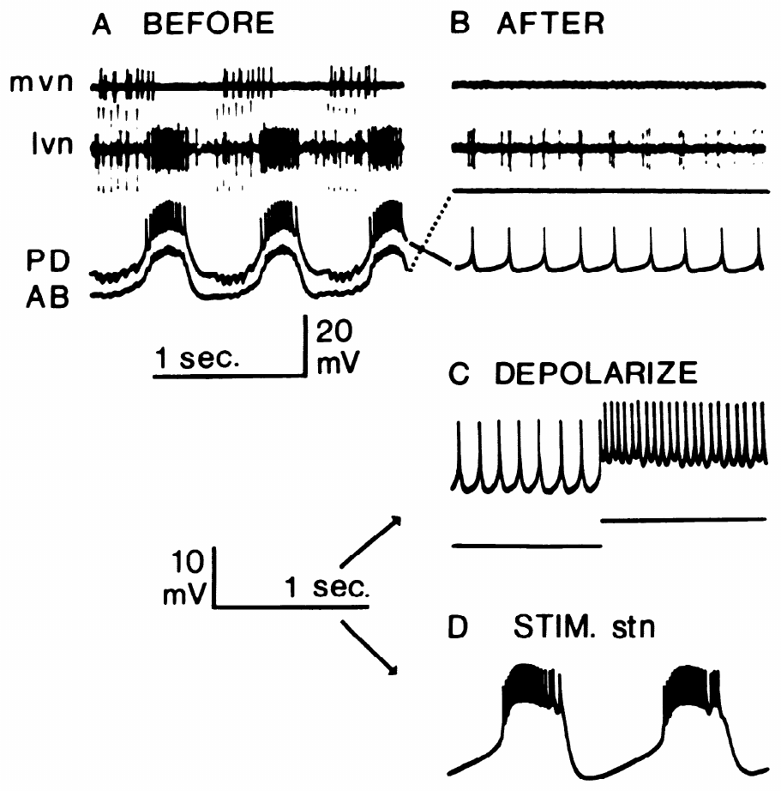
PD neurons become bursters when input recruits them
The two electrically coupled PD neurons did not behave like isolated AB. After AB and other relevant inputs were removed and the stn was blocked, PD fired tonically, meaning that spikes continued without the regularly separated slow depolarizing waves that define bursting.
Injecting depolarizing current increased tonic firing, but stimulation of the remaining input nerve recruited slow membrane oscillations. The published example used a 20 Hz stimulus train lasting 0.3 s. Oscillations outlasted the stimulus; across experiments they could continue for up to about a minute.
PD is therefore a conditional burster: an appropriate input state permits rhythm-generating properties that are absent in the isolated baseline state. The stimulation activated a collection of inputs, so the result does not identify one transmitter, receptor or channel as its sole cause.
Hooper & Marder (1987), Fig. 1(right). Lobster pyloric circuit
Miller & Selverston (1982), Fig. 3(A–D). Isolated PD is tonic; nerve stimulation recruits bursting
Miller & Selverston (1982); Hooper & Marder (1987)
08
Notes:
• The two electrically coupled PD neurons did not behave like isolated AB. After AB and other relevant inputs were removed and the stn was blocked, PD fired tonically, meaning that spikes continued without the regularly separated slow depolarizing waves that define bursting.
– The surviving PD cells were recorded after the cells supplying their normal phasic input had been disabled.
• Injecting depolarizing current increased tonic firing, but stimulation of the remaining input nerve recruited slow membrane oscillations. The published example used a 20 Hz stimulus train lasting 0.3 s. Oscillations outlasted the stimulus; across experiments they could continue for up to about a minute.
– A brief stimulation episode could change neuronal state for longer than the duration of the imposed spikes.
• PD is therefore a conditional burster: an appropriate input state permits rhythm-generating properties that are absent in the isolated baseline state. The stimulation activated a collection of inputs, so the result does not identify one transmitter, receptor or channel as its sole cause.
– Tonic current injection and nerve stimulation are different interventions; similar depolarization does not guarantee the same cellular response.
References:
Miller JP, Selverston AI. (1982). Mechanisms underlying pattern generation in lobster stomatogastric ganglion as determined by selective inactivation of identified neurons. II. Oscillatory properties of pyloric neurons. Journal of Neurophysiology 48: 1378-1391. https://doi.org/10.1152/jn.1982.48.6.1378
Hooper SL, Marder E. (1987). Modulation of the lobster pyloric rhythm by the peptide proctolin. Journal of Neuroscience 7: 2097-2112. https://doi.org/10.1523/jneurosci.07-07-02097.1987
Figure: Miller & Selverston (1982), Fig. 3(A–D). Isolated PD is tonic; nerve stimulation recruits bursting
Figure source: https://doi.org/10.1152/jn.1982.48.6.1378
Figure: Hooper & Marder (1987), Fig. 1(right). Lobster pyloric circuit
Figure source: https://doi.org/10.1523/jneurosci.07-07-02097.1987

Slide 9
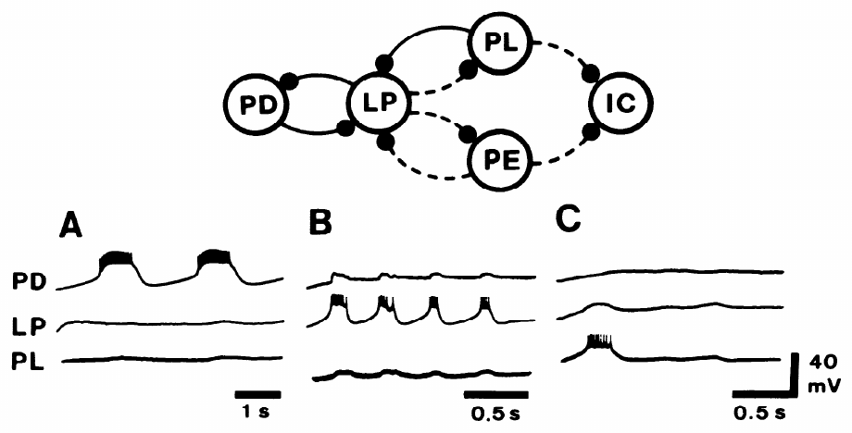
Input can recruit oscillations in follower neurons
Conditional oscillation was not confined to PD. Miller and Selverston examined a reduced lobster network after disabling AB and the ventricular dilator neuron. PD, LP and a late-firing pyloric neuron remained available for intracellular recording and controlled membrane polarization.
A 20 Hz input-nerve train lasting 0.5 s recruited voltage oscillations in the remaining neurons. Current injection suppressed selected cells to test whether an observed response required another cell’s activity. LP could express slow oscillations even when activity in the recorded PD and other pyloric cells was reduced.
The ventricular dilator (VD) neuron is a pyloric motor neuron with conditional bursting in the study’s other isolation experiments. Oscillatory capacity thus belongs to several circuit members under appropriate input conditions; AB was distinctive in bursting spontaneously after the complete tested isolation.
Miller & Selverston (1982), Fig. 4(A–C). Nerve stimulation recruits conditional membrane oscillations
Hooper & Marder (1987), Fig. 1(right). Lobster pyloric circuit
Miller & Selverston (1982); Hooper & Marder (1987)
09
Notes:
• Conditional oscillation was not confined to PD. Miller and Selverston examined a reduced lobster network after disabling AB and the ventricular dilator neuron. PD, LP and a late-firing pyloric neuron remained available for intracellular recording and controlled membrane polarization.
– Hyperpolarization makes a membrane voltage more negative, and can suppress a neuron’s spike generation or bursting.
• A 20 Hz input-nerve train lasting 0.5 s recruited voltage oscillations in the remaining neurons. Current injection suppressed selected cells to test whether an observed response required another cell’s activity. LP could express slow oscillations even when activity in the recorded PD and other pyloric cells was reduced.
– The surviving neurons were not assumed to be independent merely because they were recorded separately; imposed polarization tested the contribution of their interactions.
• The ventricular dilator (VD) neuron is a pyloric motor neuron with conditional bursting in the study’s other isolation experiments. Oscillatory capacity thus belongs to several circuit members under appropriate input conditions; AB was distinctive in bursting spontaneously after the complete tested isolation.
– The isolation results separate spontaneous endogenous bursting from input-dependent expression of oscillatory properties.
References:
Miller JP, Selverston AI. (1982). Mechanisms underlying pattern generation in lobster stomatogastric ganglion as determined by selective inactivation of identified neurons. II. Oscillatory properties of pyloric neurons. Journal of Neurophysiology 48: 1378-1391. https://doi.org/10.1152/jn.1982.48.6.1378
Hooper SL, Marder E. (1987). Modulation of the lobster pyloric rhythm by the peptide proctolin. Journal of Neuroscience 7: 2097-2112. https://doi.org/10.1523/jneurosci.07-07-02097.1987
Figure: Miller & Selverston (1982), Fig. 4(A–C). Nerve stimulation recruits conditional membrane oscillations
Figure source: https://doi.org/10.1152/jn.1982.48.6.1378
Figure: Hooper & Marder (1987), Fig. 1(right). Lobster pyloric circuit
Figure source: https://doi.org/10.1523/jneurosci.07-07-02097.1987

Slide 10
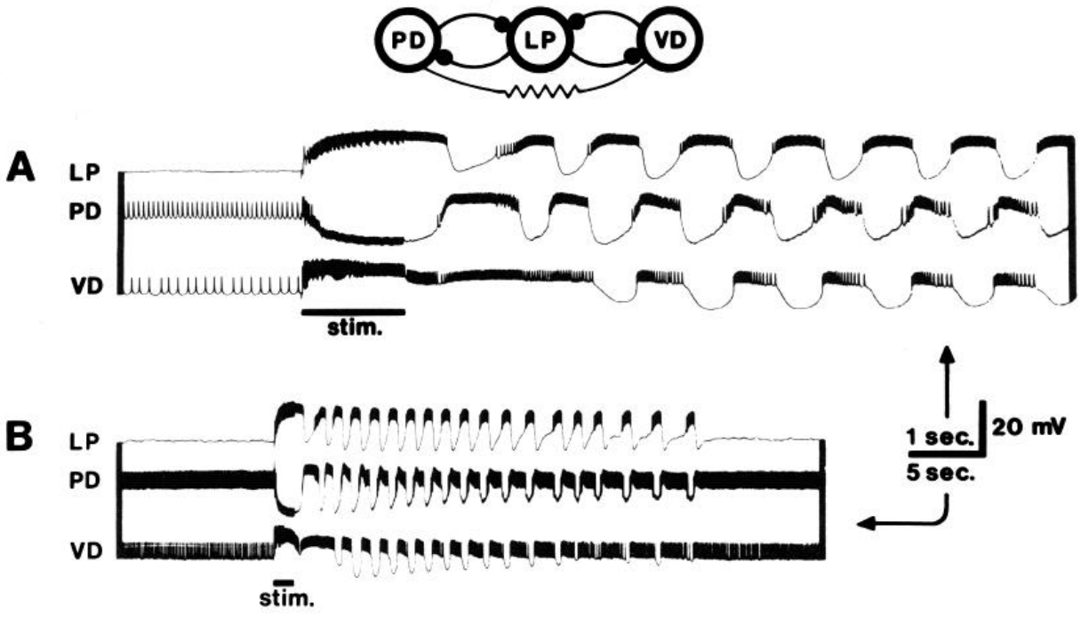
A brief input can recruit a reduced motor network
After removal of the spontaneously bursting AB neuron and several other cells, a reduced PD–LP–VD network could remain nonrhythmic when descending input was blocked. Its retained neurons had inhibitory interactions, but those connections alone did not produce continuous coordinated bursting in that state.
A 50 Hz stimulus train lasting 1.4 s in the stomatogastric nerve initiated an episode of coordinated activity. Intracellular recordings at both fast and slow time bases distinguished individual membrane waves from the longer duration of the recruited episode.
A circuit can contain the connections needed for coordinated output while lacking the active cellular state that expresses it. The recruited episode supports a contribution of conditional membrane oscillations to motor-pattern stability. It does not imply that this reduced network reproduces every muscle command of the intact pyloric system.
Miller & Selverston (1982), Fig. 5(A–B). Brief nerve stimulation recruits a reduced pyloric network
Hooper & Marder (1987), Fig. 1(right). Lobster pyloric circuit
Miller & Selverston (1982); Hooper & Marder (1987)
10
Notes:
• After removal of the spontaneously bursting AB neuron and several other cells, a reduced PD–LP–VD network could remain nonrhythmic when descending input was blocked. Its retained neurons had inhibitory interactions, but those connections alone did not produce continuous coordinated bursting in that state.
– The experiment removed AB, the neuron that had passed the spontaneous isolation test, before assessing the remaining network.
• A 50 Hz stimulus train lasting 1.4 s in the stomatogastric nerve initiated an episode of coordinated activity. Intracellular recordings at both fast and slow time bases distinguished individual membrane waves from the longer duration of the recruited episode.
– The slow recording resolves persistence after the stimulus; the fast recording resolves the relationships among individual voltage waves.
• A circuit can contain the connections needed for coordinated output while lacking the active cellular state that expresses it. The recruited episode supports a contribution of conditional membrane oscillations to motor-pattern stability. It does not imply that this reduced network reproduces every muscle command of the intact pyloric system.
– A synaptic connection constrains interactions, but the activity generated by those interactions also depends on the membrane properties of the connected cells.
References:
Miller JP, Selverston AI. (1982). Mechanisms underlying pattern generation in lobster stomatogastric ganglion as determined by selective inactivation of identified neurons. II. Oscillatory properties of pyloric neurons. Journal of Neurophysiology 48: 1378-1391. https://doi.org/10.1152/jn.1982.48.6.1378
Hooper SL, Marder E. (1987). Modulation of the lobster pyloric rhythm by the peptide proctolin. Journal of Neuroscience 7: 2097-2112. https://doi.org/10.1523/jneurosci.07-07-02097.1987
Figure: Miller & Selverston (1982), Fig. 5(A–B). Brief nerve stimulation recruits a reduced pyloric network
Figure source: https://doi.org/10.1152/jn.1982.48.6.1378
Figure: Hooper & Marder (1987), Fig. 1(right). Lobster pyloric circuit
Figure source: https://doi.org/10.1523/jneurosci.07-07-02097.1987

Slide 11
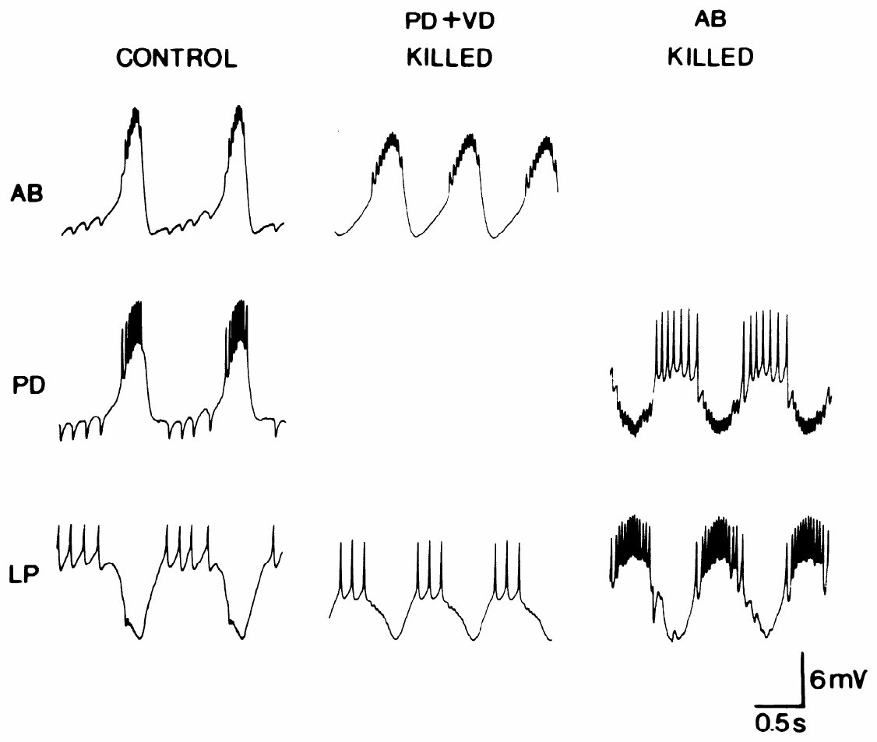
Selective deletion separates two inhibitory outputs
Synchronous activity of AB and PD produces a compound IPSP in LP. Eisen and Marder separated the contributing pathways by photoinactivating either AB or both PD neurons. The comparison preserved recordings from LP and from the surviving member of the coupled pacemaker group.
With PD removed, AB bursts still inhibited LP. With AB removed, PD depolarizations also inhibited LP, but their responses had a different time course. The intact response therefore combined two chemical inhibitory outputs that were normally activated together by the electrically coupled cells.
LP-evoked IPSPs disappeared from AB when PD was removed. The same manipulation separated a direct AB-to-LP synapse from an indirect LP influence on AB through PD. Functional connectivity must distinguish transmitter release at a synapse from voltage propagation through an electrical connection.
Hooper & Marder (1987), Fig. 1(right). Lobster pyloric circuit
Eisen & Marder (1982), Fig. 4. Selective deletion separates AB and PD synaptic outputs
Eisen & Marder (1982); Hooper & Marder (1987)
11
Notes:
• Synchronous activity of AB and PD produces a compound IPSP in LP. Eisen and Marder separated the contributing pathways by photoinactivating either AB or both PD neurons. The comparison preserved recordings from LP and from the surviving member of the coupled pacemaker group.
– The pacemaker group consists of AB and its coupled PD neurons; their synchronous activity does not make their synapses identical.
• With PD removed, AB bursts still inhibited LP. With AB removed, PD depolarizations also inhibited LP, but their responses had a different time course. The intact response therefore combined two chemical inhibitory outputs that were normally activated together by the electrically coupled cells.
– Deletion assigns a component of a compound response to the cell that actually supplies it.
• LP-evoked IPSPs disappeared from AB when PD was removed. The same manipulation separated a direct AB-to-LP synapse from an indirect LP influence on AB through PD. Functional connectivity must distinguish transmitter release at a synapse from voltage propagation through an electrical connection.
– The loss of the LP response in AB after PD deletion is more discriminating than observing LP and AB activity at the same time.
References:
Eisen JS, Marder E. (1982). Mechanisms underlying pattern generation in lobster stomatogastric ganglion as determined by selective inactivation of identified neurons. III. Synaptic connections of electrically coupled pyloric neurons. Journal of Neurophysiology 48: 1392-1415. https://doi.org/10.1152/jn.1982.48.6.1392
Hooper SL, Marder E. (1987). Modulation of the lobster pyloric rhythm by the peptide proctolin. Journal of Neuroscience 7: 2097-2112. https://doi.org/10.1523/jneurosci.07-07-02097.1987
Figure: Eisen & Marder (1982), Fig. 4. Selective deletion separates AB and PD synaptic outputs
Figure source: https://doi.org/10.1152/jn.1982.48.6.1392
Figure: Hooper & Marder (1987), Fig. 1(right). Lobster pyloric circuit
Figure source: https://doi.org/10.1523/jneurosci.07-07-02097.1987

Slide 12
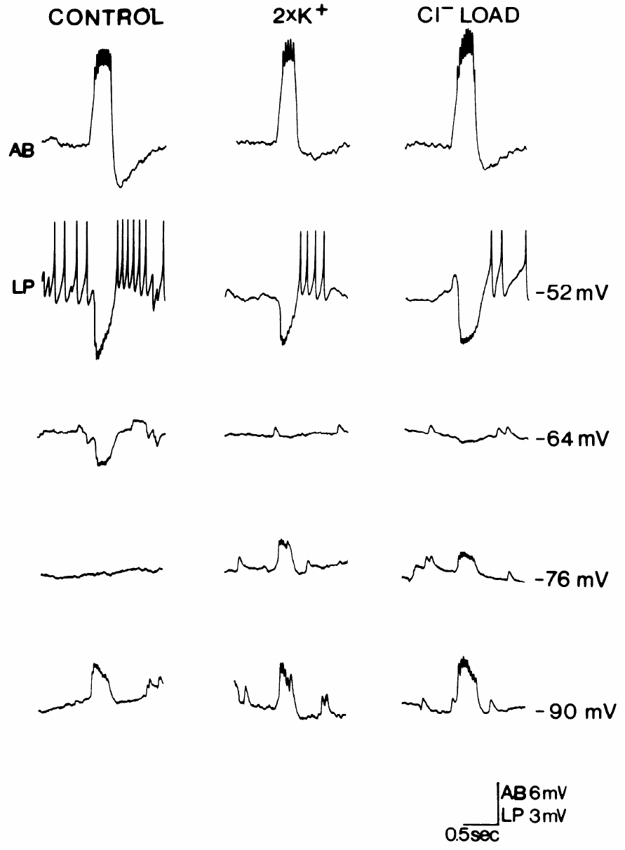
AB inhibition of LP depends strongly on chloride
After PD deletion, AB-to-LP inhibition could be tested without the overlapping PD output. Eisen and Marder varied LP membrane voltage and altered ionic conditions while evoking AB activity. The isolated response reversed near −64 mV in the published control experiment.
The reversal potential is the voltage at which a synaptic response changes sign. Doubling extracellular potassium did not shift the AB-evoked reversal appreciably. Increasing intracellular chloride shifted the response toward more positive voltages, implicating a substantial chloride contribution to its synaptic conductance.
A conductance describes how readily a membrane pathway carries electrical current. Chloride-dependent inhibition can oppose firing even when its voltage effect becomes small near reversal. These ionic manipulations constrain the mechanism of the synapse; they do not identify a molecular receptor subunit.
Hooper & Marder (1987), Fig. 1(right). Lobster pyloric circuit
Eisen & Marder (1982), Fig. 5. Chloride loading changes the isolated AB-to-LP response
Eisen & Marder (1982); Hooper & Marder (1987)
12
Notes:
• After PD deletion, AB-to-LP inhibition could be tested without the overlapping PD output. Eisen and Marder varied LP membrane voltage and altered ionic conditions while evoking AB activity. The isolated response reversed near −64 mV in the published control experiment.
– Changing the postsynaptic holding voltage separates the response’s driving force from the amount of transmitter released.
• The reversal potential is the voltage at which a synaptic response changes sign. Doubling extracellular potassium did not shift the AB-evoked reversal appreciably. Increasing intracellular chloride shifted the response toward more positive voltages, implicating a substantial chloride contribution to its synaptic conductance.
– Increasing chloride inside LP changes the ionic gradient across its membrane, so a chloride-carrying response should reverse at a different voltage.
• A conductance describes how readily a membrane pathway carries electrical current. Chloride-dependent inhibition can oppose firing even when its voltage effect becomes small near reversal. These ionic manipulations constrain the mechanism of the synapse; they do not identify a molecular receptor subunit.
– The isolated AB response differed from the potassium-sensitive inhibition supplied by PD, despite the normal synchrony of the two presynaptic neurons.
References:
Eisen JS, Marder E. (1982). Mechanisms underlying pattern generation in lobster stomatogastric ganglion as determined by selective inactivation of identified neurons. III. Synaptic connections of electrically coupled pyloric neurons. Journal of Neurophysiology 48: 1392-1415. https://doi.org/10.1152/jn.1982.48.6.1392
Hooper SL, Marder E. (1987). Modulation of the lobster pyloric rhythm by the peptide proctolin. Journal of Neuroscience 7: 2097-2112. https://doi.org/10.1523/jneurosci.07-07-02097.1987
Figure: Eisen & Marder (1982), Fig. 5. Chloride loading changes the isolated AB-to-LP response
Figure source: https://doi.org/10.1152/jn.1982.48.6.1392
Figure: Hooper & Marder (1987), Fig. 1(right). Lobster pyloric circuit
Figure source: https://doi.org/10.1523/jneurosci.07-07-02097.1987

Slide 13
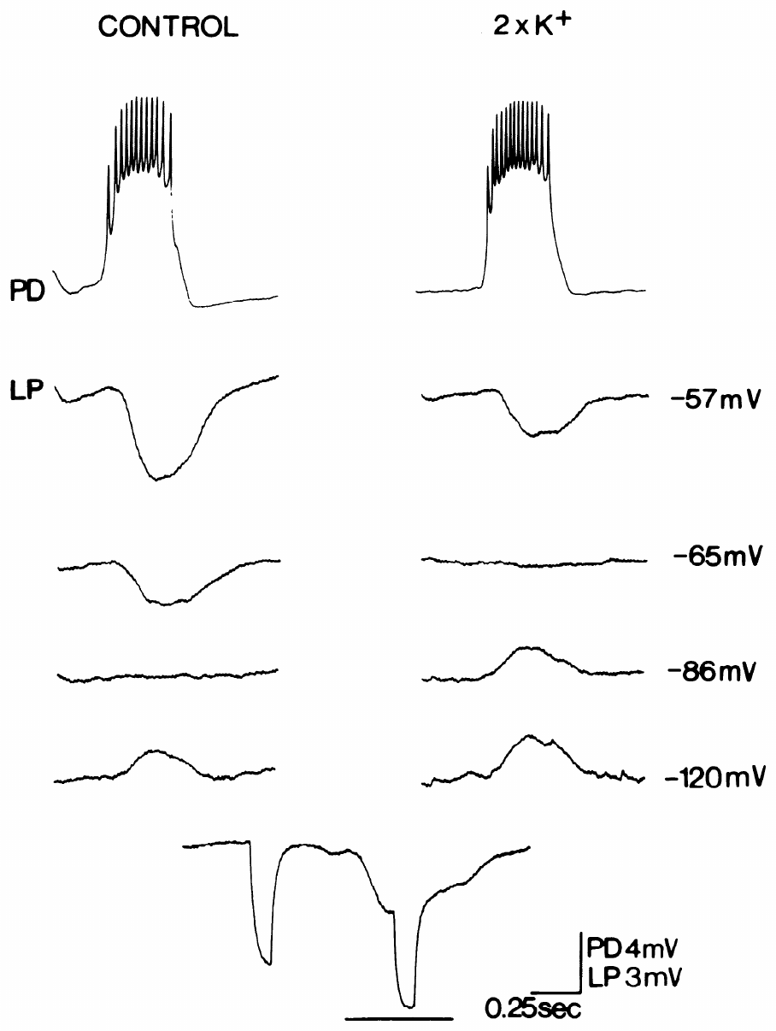
PD inhibition of LP is sensitive to potassium
Eisen and Marder isolated PD-to-LP transmission by disabling AB and VD, then depolarized PD with current pulses. LP was recorded at several membrane voltages to determine where the isolated inhibitory response changed sign. The control reversal in the published experiment was −86 mV.
Doubling extracellular potassium shifted that reversal to approximately −65 mV. Chloride loading did not produce the corresponding shift found for AB-to-LP inhibition. The PD response therefore depended strongly on potassium permeability, whereas the synchronized AB response had a different ionic basis.
An ion’s concentration gradient and the postsynaptic voltage determine the direction of its contribution to synaptic current. Two inputs can both inhibit LP at its normal operating voltage while differing in reversal, kinetics and pharmacology. Their combined effect cannot be represented as two physiologically identical synapses.
Hooper & Marder (1987), Fig. 1(right). Lobster pyloric circuit
Eisen & Marder (1982), Fig. 6. External potassium shifts the isolated PD-to-LP reversal
Eisen & Marder (1982); Hooper & Marder (1987)
13
Notes:
• Eisen and Marder isolated PD-to-LP transmission by disabling AB and VD, then depolarized PD with current pulses. LP was recorded at several membrane voltages to determine where the isolated inhibitory response changed sign. The control reversal in the published experiment was −86 mV.
– The current pulse reproduced presynaptic depolarization while allowing the experimenter to control when the PD response was evoked.
• Doubling extracellular potassium shifted that reversal to approximately −65 mV. Chloride loading did not produce the corresponding shift found for AB-to-LP inhibition. The PD response therefore depended strongly on potassium permeability, whereas the synchronized AB response had a different ionic basis.
– External potassium was an experimental manipulation of driving force, rather than a test of the number of potassium channels in the neuron.
• An ion’s concentration gradient and the postsynaptic voltage determine the direction of its contribution to synaptic current. Two inputs can both inhibit LP at its normal operating voltage while differing in reversal, kinetics and pharmacology. Their combined effect cannot be represented as two physiologically identical synapses.
– The measured ionic selectivity does not establish the identity of every channel protein involved in the synaptic response.
References:
Eisen JS, Marder E. (1982). Mechanisms underlying pattern generation in lobster stomatogastric ganglion as determined by selective inactivation of identified neurons. III. Synaptic connections of electrically coupled pyloric neurons. Journal of Neurophysiology 48: 1392-1415. https://doi.org/10.1152/jn.1982.48.6.1392
Hooper SL, Marder E. (1987). Modulation of the lobster pyloric rhythm by the peptide proctolin. Journal of Neuroscience 7: 2097-2112. https://doi.org/10.1523/jneurosci.07-07-02097.1987
Figure: Eisen & Marder (1982), Fig. 6. External potassium shifts the isolated PD-to-LP reversal
Figure source: https://doi.org/10.1152/jn.1982.48.6.1392
Figure: Hooper & Marder (1987), Fig. 1(right). Lobster pyloric circuit
Figure source: https://doi.org/10.1523/jneurosci.07-07-02097.1987

Slide 14
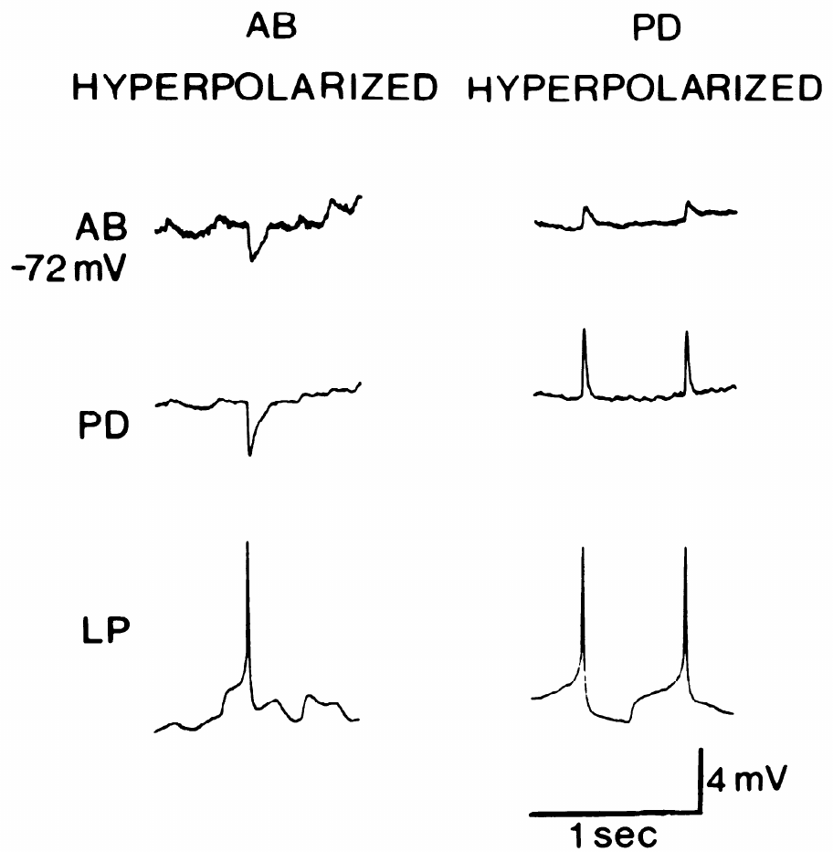
Electrical coupling can carry an indirect IPSP
An LP spike can produce a response in AB although chemical feedback directly targets PD. Eisen and Marder hyperpolarized AB or PD while recording all three cells. They tested whether the AB response followed AB voltage or the response generated in PD.
Hyperpolarizing AB to approximately −72 mV did not reverse its LP-associated IPSP. Hyperpolarizing PD instead reversed the response in PD and the voltage response appearing in AB. The AB response therefore tracked a PD synaptic event carried through electrical coupling.
Electrotonic spread is passive propagation of a voltage change through a connected electrical pathway. A neuron may receive such a propagated response without possessing the corresponding chemical synapse. A connection map based only on spike-correlated voltage changes can consequently assign the wrong presynaptic target.
Hooper & Marder (1987), Fig. 1(right). Lobster pyloric circuit
Eisen & Marder (1982), Fig. 9. LP-evoked potentials reverse together during PD polarization
Eisen & Marder (1982); Hooper & Marder (1987)
14
Notes:
• An LP spike can produce a response in AB although chemical feedback directly targets PD. Eisen and Marder hyperpolarized AB or PD while recording all three cells. They tested whether the AB response followed AB voltage or the response generated in PD.
– The manipulation compared the two cells at similar negative voltages, but changed which cell was directly polarized.
• Hyperpolarizing AB to approximately −72 mV did not reverse its LP-associated IPSP. Hyperpolarizing PD instead reversed the response in PD and the voltage response appearing in AB. The AB response therefore tracked a PD synaptic event carried through electrical coupling.
– If LP released transmitter directly onto AB, changing AB’s own membrane voltage should govern the local synaptic reversal.
• Electrotonic spread is passive propagation of a voltage change through a connected electrical pathway. A neuron may receive such a propagated response without possessing the corresponding chemical synapse. A connection map based only on spike-correlated voltage changes can consequently assign the wrong presynaptic target.
– The results require a chemical LP-to-PD connection plus electrical propagation from PD into AB.
References:
Eisen JS, Marder E. (1982). Mechanisms underlying pattern generation in lobster stomatogastric ganglion as determined by selective inactivation of identified neurons. III. Synaptic connections of electrically coupled pyloric neurons. Journal of Neurophysiology 48: 1392-1415. https://doi.org/10.1152/jn.1982.48.6.1392
Hooper SL, Marder E. (1987). Modulation of the lobster pyloric rhythm by the peptide proctolin. Journal of Neuroscience 7: 2097-2112. https://doi.org/10.1523/jneurosci.07-07-02097.1987
Figure: Eisen & Marder (1982), Fig. 9. LP-evoked potentials reverse together during PD polarization
Figure source: https://doi.org/10.1152/jn.1982.48.6.1392
Figure: Hooper & Marder (1987), Fig. 1(right). Lobster pyloric circuit
Figure source: https://doi.org/10.1523/jneurosci.07-07-02097.1987

Slide 15
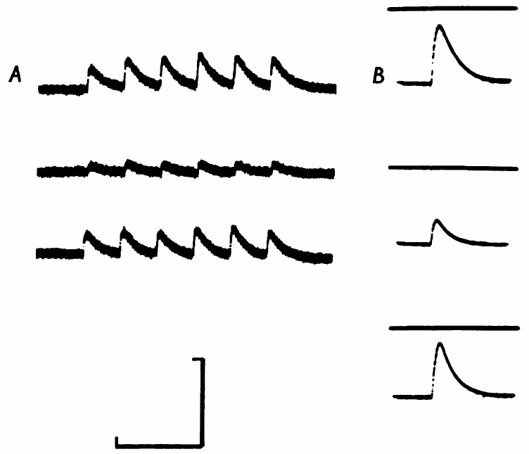
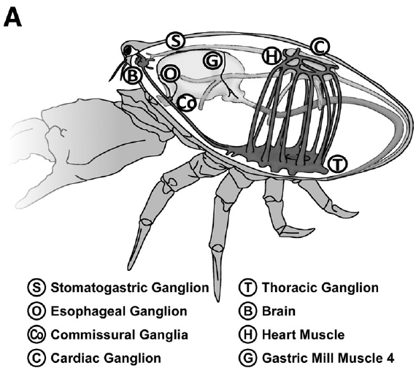
Acetylcholine excites the lobster dorsal dilator
Marder tested transmitter identity at the lobster PD-to-muscle junction. Acetylcholine (ACh) is a small-molecule neurotransmitter; applying it locally to the dorsal dilator produced a depolarizing response. Stimulating the PD motor nerve produced an excitatory junctional potential, the muscle voltage response to neural transmitter release.
Hexamethonium reversibly reduced both the nerve-evoked response and the response to applied ACh. Washout restored them toward their control amplitudes. Local ACh delivery and motor-nerve stimulation therefore interrogated a pharmacologically similar postsynaptic pathway in the same muscle system.
A transmitter candidate is stronger when it reproduces the nerve response and shares its antagonist sensitivity. Drug sensitivity alone is insufficient because a compound may affect more than one receptor class. These experiments support cholinergic transmission without assigning a modern molecular receptor subtype.
Garcia et al. (2015), Fig. 3(A). Crab foregut anatomy
Marder (1976), Fig. 2(A–B). Hexamethonium reversibly reduces nerve and ACh responses
Marder (1976); Garcia et al. (2015)
15
Notes:
• Marder tested transmitter identity at the lobster PD-to-muscle junction. Acetylcholine (ACh) is a small-molecule neurotransmitter; applying it locally to the dorsal dilator produced a depolarizing response. Stimulating the PD motor nerve produced an excitatory junctional potential, the muscle voltage response to neural transmitter release.
– Iontophoresis delivers a charged substance from a pipette with electrical current, allowing a localized test of the muscle’s response.
– The anatomical localization in Garcia and colleagues is from the crab; the transmitter and muscle experiments discussed here are from the spiny lobster.
• Hexamethonium reversibly reduced both the nerve-evoked response and the response to applied ACh. Washout restored them toward their control amplitudes. Local ACh delivery and motor-nerve stimulation therefore interrogated a pharmacologically similar postsynaptic pathway in the same muscle system.
– The comparison included normal saline, antagonist exposure and saline wash, separating a reversible drug action from irreversible tissue failure.
• A transmitter candidate is stronger when it reproduces the nerve response and shares its antagonist sensitivity. Drug sensitivity alone is insufficient because a compound may affect more than one receptor class. These experiments support cholinergic transmission without assigning a modern molecular receptor subtype.
– Excitation at the muscle does not mean that the same transmitter excites every neuron onto which PD releases it.
References:
Marder E. (1976). Cholinergic motor neurones in the stomatogastric system of the lobster. The Journal of Physiology 257: 63-86. https://doi.org/10.1113/jphysiol.1976.sp011356
Garcia VJ, Daur N, Temporal S, Schulz DJ, Bucher D. (2015). Neuropeptide receptor transcript expression levels and magnitude of ionic current responses show cell type-specific differences in a small motor circuit. Journal of Neuroscience 35: 6786-6800. https://doi.org/10.1523/jneurosci.0171-15.2015
Figure: Marder (1976), Fig. 2(A–B). Hexamethonium reversibly reduces nerve and ACh responses
Figure source: https://doi.org/10.1113/jphysiol.1976.sp011356
Figure: Garcia et al. (2015), Fig. 3(A). Crab foregut anatomy
Figure source: https://doi.org/10.1523/jneurosci.0171-15.2015

Slide 16
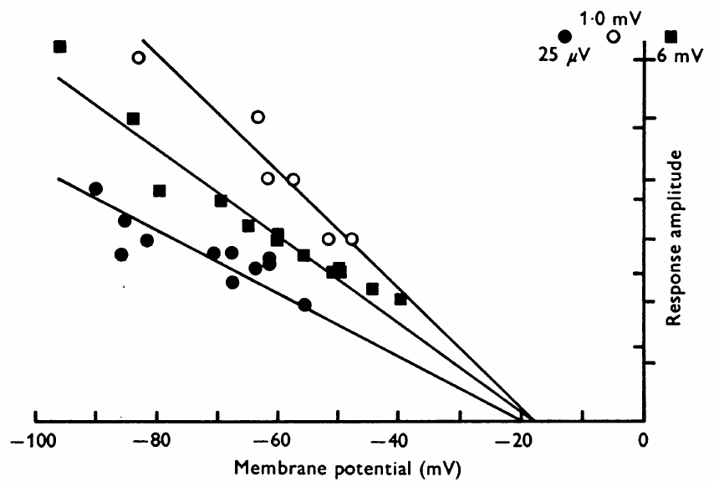
Nerve and ACh responses reverse at similar voltages
Marder compared the voltage dependence of applied ACh responses with the dorsal dilator’s nerve-evoked junctional responses. The muscle membrane was polarized to different voltages, and response amplitude was measured using intracellular and focal extracellular recording approaches.
The ACh response extrapolated to a reversal near −18 mV in the recorded experiment. Nerve-evoked responses reversed in a similar negative voltage range. A depolarization makes the membrane less negative; its amplitude declines as the muscle voltage approaches the response’s reversal potential.
Similar reversal behavior supports a shared postsynaptic ionic mechanism for the applied transmitter and the neural response. Receptor desensitization and large response amplitudes could distort the extrapolation, so Marder used small responses and controlled application timing. The agreement strengthens transmitter identification without directly observing individual molecules released from PD.
Garcia et al. (2015), Fig. 3(A). Crab foregut anatomy
Marder (1976), Fig. 7. Nerve-evoked and ACh responses reverse at similar voltages
Marder (1976); Garcia et al. (2015)
16
Notes:
• Marder compared the voltage dependence of applied ACh responses with the dorsal dilator’s nerve-evoked junctional responses. The muscle membrane was polarized to different voltages, and response amplitude was measured using intracellular and focal extracellular recording approaches.
– Focal extracellular recording placed the electrode near an active junction, while intracellular recording measured the muscle fiber’s membrane voltage.
• The ACh response extrapolated to a reversal near −18 mV in the recorded experiment. Nerve-evoked responses reversed in a similar negative voltage range. A depolarization makes the membrane less negative; its amplitude declines as the muscle voltage approaches the response’s reversal potential.
– The reversal estimate summarizes an electrical property of the response; it is not the muscle’s resting voltage.
• Similar reversal behavior supports a shared postsynaptic ionic mechanism for the applied transmitter and the neural response. Receptor desensitization and large response amplitudes could distort the extrapolation, so Marder used small responses and controlled application timing. The agreement strengthens transmitter identification without directly observing individual molecules released from PD.
– Desensitization is a reduction in responsiveness during repeated or sustained agonist exposure, and can make successive application tests misleading.
References:
Marder E. (1976). Cholinergic motor neurones in the stomatogastric system of the lobster. The Journal of Physiology 257: 63-86. https://doi.org/10.1113/jphysiol.1976.sp011356
Garcia VJ, Daur N, Temporal S, Schulz DJ, Bucher D. (2015). Neuropeptide receptor transcript expression levels and magnitude of ionic current responses show cell type-specific differences in a small motor circuit. Journal of Neuroscience 35: 6786-6800. https://doi.org/10.1523/jneurosci.0171-15.2015
Figure: Marder (1976), Fig. 7. Nerve-evoked and ACh responses reverse at similar voltages
Figure source: https://doi.org/10.1113/jphysiol.1976.sp011356
Figure: Garcia et al. (2015), Fig. 3(A). Crab foregut anatomy
Figure source: https://doi.org/10.1523/jneurosci.0171-15.2015

Slide 17
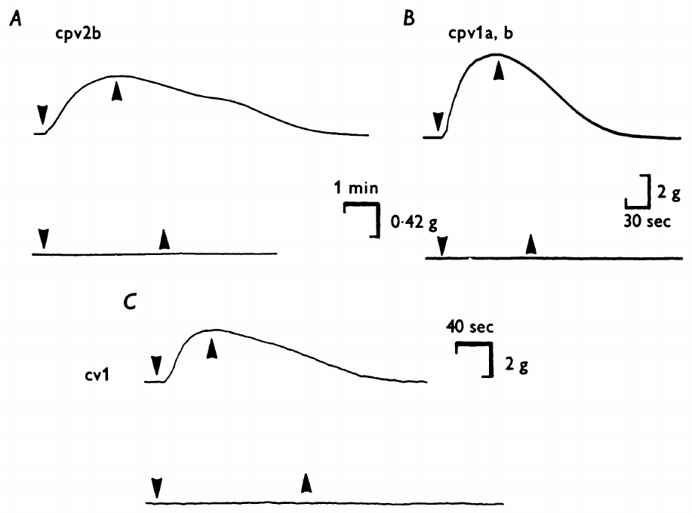
Motor-neuron classes differ in transmitter evidence
Marder screened muscles innervated by identified lobster motor-neuron classes with ACh and L-glutamate. Glutamate is another small-molecule transmitter. PD-innervated dilators and the VD-innervated muscle contracted in ACh, whereas the LP/PY region and inferior cardiac muscle responded to glutamate.
An unresponsive bath application was checked against nerve-evoked contraction. In the LP/PY preparation, stimulation at 10 pulses/s for 2 s confirmed that the muscles were still viable. Choline acetyltransferase assays provided separate evidence for ACh synthesis in identified neuronal cell bodies.
The combined evidence assigned ACh or glutamate as transmitter candidates for different motor classes. The strongest detailed physiological identification concerned PD; several other assignments remained putative. A candidate inferred from muscle sensitivity and synthesis should be distinguished from complete proof of its release and action at every central synapse.
Garcia et al. (2015), Fig. 3(A). Crab foregut anatomy
Marder (1976), Fig. 8(A–C). Dilator muscles contract in acetylcholine rather than glutamate
Marder (1976); Garcia et al. (2015)
17
Notes:
• Marder screened muscles innervated by identified lobster motor-neuron classes with ACh and L-glutamate. Glutamate is another small-molecule transmitter. PD-innervated dilators and the VD-innervated muscle contracted in ACh, whereas the LP/PY region and inferior cardiac muscle responded to glutamate.
– Choline acetyltransferase is the enzyme that synthesizes acetylcholine, so its presence supplies biochemical evidence distinct from a muscle’s drug response.
• An unresponsive bath application was checked against nerve-evoked contraction. In the LP/PY preparation, stimulation at 10 pulses/s for 2 s confirmed that the muscles were still viable. Choline acetyltransferase assays provided separate evidence for ACh synthesis in identified neuronal cell bodies.
– The inferior cardiac neuron is abbreviated IC; the name refers to a foregut motor neuron, rather than a neuron controlling the heart.
• The combined evidence assigned ACh or glutamate as transmitter candidates for different motor classes. The strongest detailed physiological identification concerned PD; several other assignments remained putative. A candidate inferred from muscle sensitivity and synthesis should be distinguished from complete proof of its release and action at every central synapse.
– A peripheral muscle can be excited by a transmitter that mediates inhibition at another target, because postsynaptic receptor and ionic mechanisms differ.
References:
Marder E. (1976). Cholinergic motor neurones in the stomatogastric system of the lobster. The Journal of Physiology 257: 63-86. https://doi.org/10.1113/jphysiol.1976.sp011356
Garcia VJ, Daur N, Temporal S, Schulz DJ, Bucher D. (2015). Neuropeptide receptor transcript expression levels and magnitude of ionic current responses show cell type-specific differences in a small motor circuit. Journal of Neuroscience 35: 6786-6800. https://doi.org/10.1523/jneurosci.0171-15.2015
Figure: Marder (1976), Fig. 8(A–C). Dilator muscles contract in acetylcholine rather than glutamate
Figure source: https://doi.org/10.1113/jphysiol.1976.sp011356
Figure: Garcia et al. (2015), Fig. 3(A). Crab foregut anatomy
Figure source: https://doi.org/10.1523/jneurosci.0171-15.2015

Slide 18
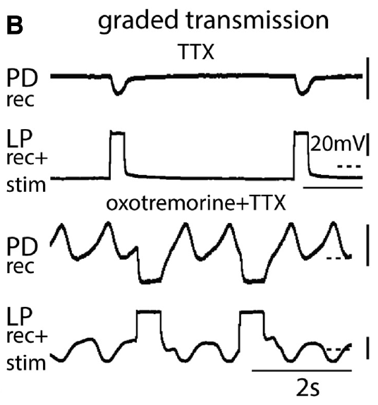
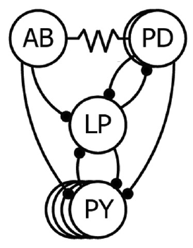
Slow presynaptic depolarization can release transmitter
In crab pyloric neurons, chemical transmission has both spike-mediated and graded components. Graded transmission varies with the presynaptic membrane potential and does not require a full action potential. Rosenbaum and Marder tested it while tetrodotoxin, or TTX, blocked the voltage-gated sodium channels needed for spiking.
LP was depolarized from −60 mV to −20 mV for 500 ms while PD was held near −50 mV. PD developed an inhibitory response despite the absence of presynaptic spikes. Holding the postsynaptic voltage constant reduced differences in response amplitude caused merely by changing driving force.
The LP-to-PD pathway can therefore transmit a slow voltage signal through transmitter release. A motor circuit’s synaptic communication cannot be inferred exclusively from spike counts. This result concerns central synaptic potentials; it does not imply that a spike-free isolated circuit produces normal muscle contractions.
Rosenbaum & Marder (2018), Fig. 1(C). Pyloric circuit
Rosenbaum & Marder (2018), Fig. 6(B). Presynaptic depolarization evokes graded inhibition without spikes
Rosenbaum & Marder (2018)
18
Notes:
• In crab pyloric neurons, chemical transmission has both spike-mediated and graded components. Graded transmission varies with the presynaptic membrane potential and does not require a full action potential. Rosenbaum and Marder tested it while tetrodotoxin, or TTX, blocked the voltage-gated sodium channels needed for spiking.
– Voltage-gated channels change their probability of opening when the membrane voltage changes; TTX selectively blocks a major sodium-dependent spike mechanism.
• LP was depolarized from −60 mV to −20 mV for 500 ms while PD was held near −50 mV. PD developed an inhibitory response despite the absence of presynaptic spikes. Holding the postsynaptic voltage constant reduced differences in response amplitude caused merely by changing driving force.
– The presynaptic voltage step and the postsynaptic voltage control separate transmitter-release conditions from the voltage at which the response is measured.
• The LP-to-PD pathway can therefore transmit a slow voltage signal through transmitter release. A motor circuit’s synaptic communication cannot be inferred exclusively from spike counts. This result concerns central synaptic potentials; it does not imply that a spike-free isolated circuit produces normal muscle contractions.
– An inhibitory graded response provides feedback to the pacemaker even when spikes have been experimentally removed.
References:
Rosenbaum P, Marder E. (2018). Graded Transmission without Action Potentials Sustains Rhythmic Activity in Some But Not All Modulators That Activate the Same Current. Journal of Neuroscience 38: 8976-8988. https://doi.org/10.1523/jneurosci.2632-17.2018
Figure: Rosenbaum & Marder (2018), Fig. 6(B). Presynaptic depolarization evokes graded inhibition without spikes
Figure source: https://doi.org/10.1523/jneurosci.2632-17.2018
Figure: Rosenbaum & Marder (2018), Fig. 1(C). Pyloric circuit
Figure source: https://doi.org/10.1523/jneurosci.2632-17.2018

Slide 19
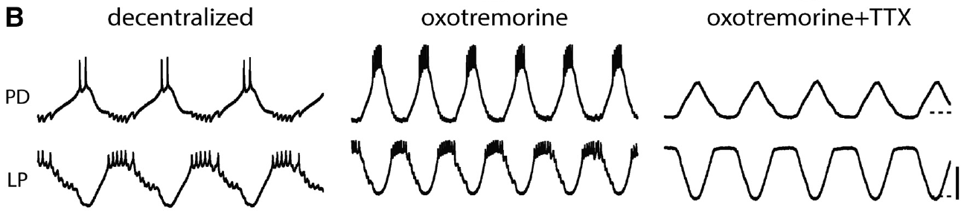
Muscarinic activation can sustain a spike-free rhythm
Rosenbaum and Marder first blocked descending input to the crab STG, then applied a modulator and finally added TTX. Oxotremorine is an agonist that activates muscarinic acetylcholine receptors. These receptors alter cellular state rather than supplying the brief muscle-junction response tested in the lobster experiments.
Oxotremorine at 10 μM increased the pyloric activity of the decentralized preparation. Addition of 0.1 μM TTX removed action potentials while PD and LP retained alternating slow membrane oscillations. Intracellular voltage records were essential because extracellular motor nerves no longer contained the usual spikes.
Slow voltage dynamics and graded inhibition can sustain central rhythmicity in this modulatory state. Persistence after sodium-channel blockade does not mean that spikes never contribute to the intact rhythm. Nor does it establish normal behavioral output, which requires commands to reach the muscles.
Rosenbaum & Marder (2018), Fig. 2(B). Oxotremorine sustains slow oscillations after spike blockade
Rosenbaum & Marder (2018), Fig. 1(C). Pyloric circuit
Rosenbaum & Marder (2018)
19
Notes:
• Rosenbaum and Marder first blocked descending input to the crab STG, then applied a modulator and finally added TTX. Oxotremorine is an agonist that activates muscarinic acetylcholine receptors. These receptors alter cellular state rather than supplying the brief muscle-junction response tested in the lobster experiments.
– An agonist is a substance that activates a receptor; muscarinic receptors are a class of acetylcholine receptor associated with slower modulation.
• Oxotremorine at 10 μM increased the pyloric activity of the decentralized preparation. Addition of 0.1 μM TTX removed action potentials while PD and LP retained alternating slow membrane oscillations. Intracellular voltage records were essential because extracellular motor nerves no longer contained the usual spikes.
– Decentralization removes descending modulatory input, making the bath-applied compound the controlled source of the tested modulatory drive.
• Slow voltage dynamics and graded inhibition can sustain central rhythmicity in this modulatory state. Persistence after sodium-channel blockade does not mean that spikes never contribute to the intact rhythm. Nor does it establish normal behavioral output, which requires commands to reach the muscles.
– The before-modulator, after-modulator and after-TTX sequence distinguishes restoration of a rhythm from its dependence on spiking.
References:
Rosenbaum P, Marder E. (2018). Graded Transmission without Action Potentials Sustains Rhythmic Activity in Some But Not All Modulators That Activate the Same Current. Journal of Neuroscience 38: 8976-8988. https://doi.org/10.1523/jneurosci.2632-17.2018
Figure: Rosenbaum & Marder (2018), Fig. 2(B). Oxotremorine sustains slow oscillations after spike blockade
Figure source: https://doi.org/10.1523/jneurosci.2632-17.2018
Figure: Rosenbaum & Marder (2018), Fig. 1(C). Pyloric circuit
Figure source: https://doi.org/10.1523/jneurosci.2632-17.2018

Slide 20
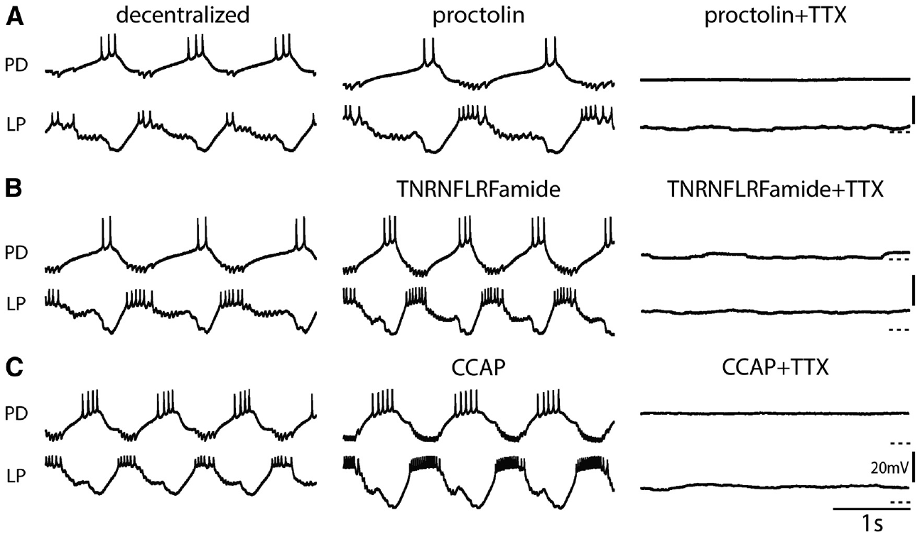
Similar activating peptides differ in spike dependence
Neuropeptides are short chains of amino acids released as chemical signals that can alter neuronal activity. Rosenbaum and Marder compared several peptides that activate the same modulator-activated inward current, I_MI, a voltage-dependent current carried by nonspecific cation channels, in different subsets of crab pyloric neurons.
Proctolin, TNRNFLRFamide and crustacean cardioactive peptide, or CCAP, each at 1 μM, activated robust pyloric rhythms after decentralization. Adding TTX stopped the rhythms in the published examples. By contrast, oxotremorine and the tachykinin-related peptide CabTRP1a supported slow oscillations without spikes.
Activation of a common inward current is not sufficient to predict whether a network can oscillate after spike blockade. Target-cell distributions, synaptic actions and other currents can differ among modulators. The experiment establishes state-dependent reliance on spikes, rather than one universal mechanism for all peptide-activated rhythms.
Rosenbaum & Marder (2018), Fig. 3(A–C). Proctolin, FLRFamide and CCAP rhythms stop in TTX
Rosenbaum & Marder (2018), Fig. 1(C). Pyloric circuit
Rosenbaum & Marder (2018)
20
Notes:
• Neuropeptides are short chains of amino acids released as chemical signals that can alter neuronal activity. Rosenbaum and Marder compared several peptides that activate the same modulator-activated inward current, IMI, a voltage-dependent current carried by nonspecific cation channels, in different subsets of crab pyloric neurons.
– An inward current carries net positive charge into the cell and can promote depolarization. Extracellular calcium blocks I_MI at strongly negative membrane voltages; relief of that block during depolarization can amplify slow voltage waves.
• Proctolin, TNRNFLRFamide and crustacean cardioactive peptide, or CCAP, each at 1 μM, activated robust pyloric rhythms after decentralization. Adding TTX stopped the rhythms in the published examples. By contrast, oxotremorine and the tachykinin-related peptide CabTRP1a supported slow oscillations without spikes.
– CabTRP1a means Cancer borealis tachykinin-related peptide Ia; its name identifies the peptide rather than a distinct neuron.
• Activation of a common inward current is not sufficient to predict whether a network can oscillate after spike blockade. Target-cell distributions, synaptic actions and other currents can differ among modulators. The experiment establishes state-dependent reliance on spikes, rather than one universal mechanism for all peptide-activated rhythms.
– Each compound was tested as a controlled bath application, so the comparison does not imply equal natural release patterns in the animal.
References:
Rosenbaum P, Marder E. (2018). Graded Transmission without Action Potentials Sustains Rhythmic Activity in Some But Not All Modulators That Activate the Same Current. Journal of Neuroscience 38: 8976-8988. https://doi.org/10.1523/jneurosci.2632-17.2018
Figure: Rosenbaum & Marder (2018), Fig. 3(A–C). Proctolin, FLRFamide and CCAP rhythms stop in TTX
Figure source: https://doi.org/10.1523/jneurosci.2632-17.2018
Figure: Rosenbaum & Marder (2018), Fig. 1(C). Pyloric circuit
Figure source: https://doi.org/10.1523/jneurosci.2632-17.2018

Slide 21
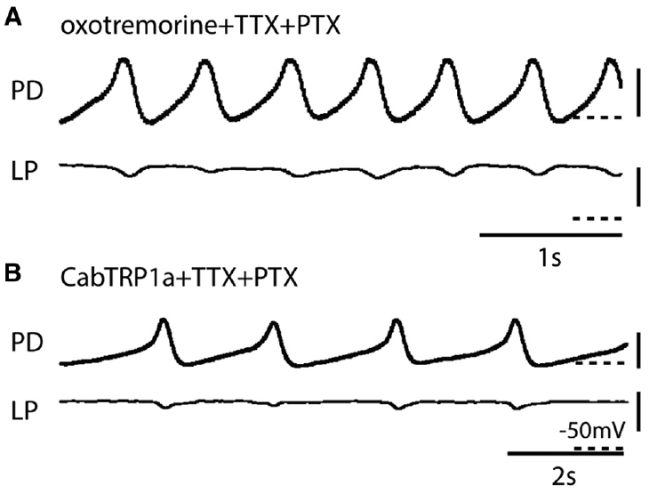
The pacemaker can oscillate without follower feedback
The AB–PD ensemble can be examined after feedback from glutamatergic follower neurons is blocked. Picrotoxin (PTX) blocks the relevant glutamatergic inhibitory synapses in this preparation. Rosenbaum and Marder combined PTX with TTX to separate pacemaker oscillation from spikes and major follower feedback.
In oxotremorine or CabTRP1a, PD retained slow oscillations after both drugs were added. LP activity was greatly reduced, yet the remaining pacemaker wave continued. The intracellular records used 20 mV voltage calibration and 1–2 s time calibration.
The result localizes a rhythm-generating capability to the electrically coupled AB–PD group under these modulatory conditions. PTX is a pharmacological isolation procedure, not physical removal of every neuron. Persistence of the pacemaker does not specify which coupled member or which individual channel is sufficient on its own.
Rosenbaum & Marder (2018), Fig. 1(C). Pyloric circuit
Rosenbaum & Marder (2018), Fig. 8(A–B). Isolated AB–PD oscillations persist in TTX with selected modulators
Rosenbaum & Marder (2018)
21
Notes:
• The AB–PD ensemble can be examined after feedback from glutamatergic follower neurons is blocked. Picrotoxin (PTX) blocks the relevant glutamatergic inhibitory synapses in this preparation. Rosenbaum and Marder combined PTX with TTX to separate pacemaker oscillation from spikes and major follower feedback.
– AB and PD remain electrically connected when follower chemical synapses are blocked, so the retained oscillator is an ensemble.
• In oxotremorine or CabTRP1a, PD retained slow oscillations after both drugs were added. LP activity was greatly reduced, yet the remaining pacemaker wave continued. The intracellular records used 20 mV voltage calibration and 1–2 s time calibration.
– TTX prevents the usual sodium-dependent spikes, while PTX removes a different component: the inhibitory feedback carried by glutamatergic synapses.
• The result localizes a rhythm-generating capability to the electrically coupled AB–PD group under these modulatory conditions. PTX is a pharmacological isolation procedure, not physical removal of every neuron. Persistence of the pacemaker does not specify which coupled member or which individual channel is sufficient on its own.
– The combination tests the dependence of the central voltage rhythm on two mechanisms without measuring the behavior of the whole crab.
References:
Rosenbaum P, Marder E. (2018). Graded Transmission without Action Potentials Sustains Rhythmic Activity in Some But Not All Modulators That Activate the Same Current. Journal of Neuroscience 38: 8976-8988. https://doi.org/10.1523/jneurosci.2632-17.2018
Figure: Rosenbaum & Marder (2018), Fig. 8(A–B). Isolated AB–PD oscillations persist in TTX with selected modulators
Figure source: https://doi.org/10.1523/jneurosci.2632-17.2018
Figure: Rosenbaum & Marder (2018), Fig. 1(C). Pyloric circuit
Figure source: https://doi.org/10.1523/jneurosci.2632-17.2018

Slide 22
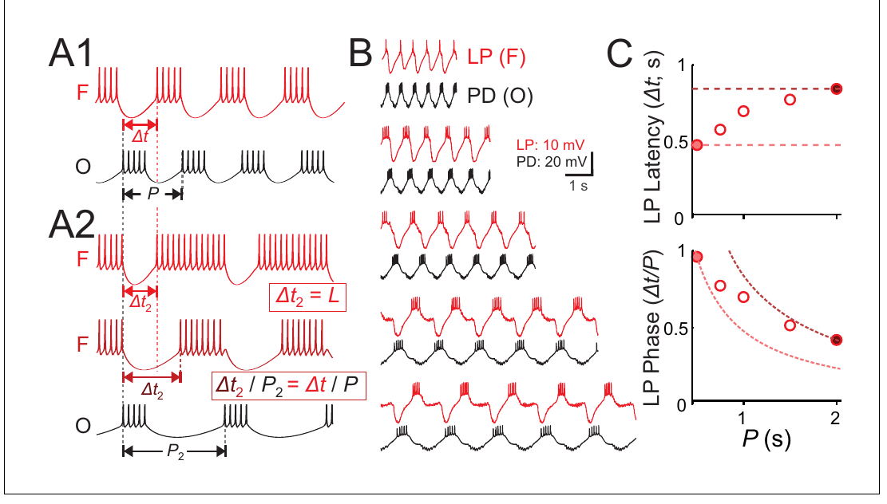
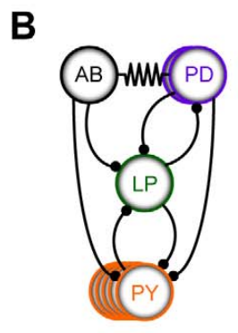
LP latency and phase change differently with period
Cycle period is the interval between successive starts of a rhythm. Latency is the time from a reference event to a response, whereas phase expresses that delay as a fraction of the cycle. A fixed latency therefore does not automatically preserve phase when the cycle changes.
Martinez and colleagues voltage-clamped a crab PD neuron with a recorded waveform repeated at different periods. Voltage clamp holds a membrane to a commanded voltage by injecting the required current. LP followed the imposed rhythm, but its onset latency and normalized onset phase changed differently.
The measured LP phase declined as period increased, rather than remaining perfectly constant. Imposed pacemaker waveforms separated the timing of inhibition from the free-running network’s normal adjustments. This preparation tests mechanisms of phase control, not a claim that natural pyloric phase is always invariant.
Martinez et al. (2019), Fig. 1(A–C). Published timing alternatives and recorded PD–LP latency and phase
Tang et al. (2010), Fig. 2(B). Crab pyloric circuit
Martinez et al. (2019); Tang et al. (2010)
22
Notes:
• Cycle period is the interval between successive starts of a rhythm. Latency is the time from a reference event to a response, whereas phase expresses that delay as a fraction of the cycle. A fixed latency therefore does not automatically preserve phase when the cycle changes.
– The published conceptual alternatives distinguish constant delay from constant relative timing; the physiological records and measurements test where LP falls between those alternatives.
• Martinez and colleagues voltage-clamped a crab PD neuron with a recorded waveform repeated at different periods. Voltage clamp holds a membrane to a commanded voltage by injecting the required current. LP followed the imposed rhythm, but its onset latency and normalized onset phase changed differently.
– The voltage command used a waveform recorded from PD, so the experiment preserved a realistic presynaptic voltage shape while changing its repetition rate.
• The measured LP phase declined as period increased, rather than remaining perfectly constant. Imposed pacemaker waveforms separated the timing of inhibition from the free-running network’s normal adjustments. This preparation tests mechanisms of phase control, not a claim that natural pyloric phase is always invariant.
– The period range in the plotted experiment spans fractions of a second to around two seconds, with latency measured in seconds and phase expressed without units.
References:
Martinez D, Anwar H, Bose A, Bucher DM, Nadim F. (2019). Short-term synaptic dynamics control the activity phase of neurons in an oscillatory network. eLife 8: e46911. https://doi.org/10.7554/elife.46911
Tang LS, Goeritz ML, Caplan JS, Taylor AL, Fisek M, Marder E. (2010). Precise temperature compensation of phase in a rhythmic motor pattern. PLoS Biology 8: e1000469. https://doi.org/10.1371/journal.pbio.1000469
Figure: Martinez et al. (2019), Fig. 1(A–C). Published timing alternatives and recorded PD–LP latency and phase
Figure source: https://doi.org/10.7554/elife.46911
Figure: Tang et al. (2010), Fig. 2(B). Crab pyloric circuit
Figure source: https://doi.org/10.1371/journal.pbio.1000469

Slide 23
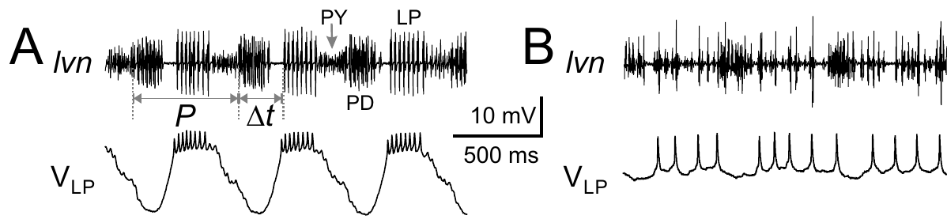
Glutamatergic input is required for normal LP bursts
Martinez and colleagues recorded LP intracellularly while monitoring the crab lateral ventricular nerve. LP normally received alternating inhibition from the pacemaker and other pyloric neurons. Its recurring bursts depended on those inputs interacting with its own membrane properties.
Bath application of 10 μM picrotoxin blocked glutamatergic inhibition from AB and PY. LP’s organized slow bursting disappeared while activity from other pyloric neurons remained visible on the nerve. The published comparison used a 500 ms time calibration and a 10 mV intracellular voltage calibration.
Loss of LP rhythmicity after removal of particular inputs distinguishes a follower neuron from an autonomous oscillator in this condition. The remaining cholinergic PD synapse means that pharmacological isolation was incomplete. The experiment assigns a requirement to the blocked pathways, rather than proving that all synaptic inputs are interchangeable.
Martinez et al. (2019), Fig. 2(A–B). Blocking glutamatergic input disrupts LP bursting
Tang et al. (2010), Fig. 2(B). Crab pyloric circuit
Martinez et al. (2019); Tang et al. (2010)
23
Notes:
• Martinez and colleagues recorded LP intracellularly while monitoring the crab lateral ventricular nerve. LP normally received alternating inhibition from the pacemaker and other pyloric neurons. Its recurring bursts depended on those inputs interacting with its own membrane properties.
– A follower neuron can generate spikes and rebound responses without generating a self-sustaining rhythm when its coordinating inhibition is removed.
• Bath application of 10 μM picrotoxin blocked glutamatergic inhibition from AB and PY. LP’s organized slow bursting disappeared while activity from other pyloric neurons remained visible on the nerve. The published comparison used a 500 ms time calibration and a 10 mV intracellular voltage calibration.
– Picrotoxin blocks the relevant glutamatergic inhibitory pathways here; it should not be treated as a universal blocker of every chemical synapse.
• Loss of LP rhythmicity after removal of particular inputs distinguishes a follower neuron from an autonomous oscillator in this condition. The remaining cholinergic PD synapse means that pharmacological isolation was incomplete. The experiment assigns a requirement to the blocked pathways, rather than proving that all synaptic inputs are interchangeable.
– The surviving nerve units help distinguish selective disruption of LP’s timing from a preparation-wide failure of neuronal activity.
References:
Martinez D, Anwar H, Bose A, Bucher DM, Nadim F. (2019). Short-term synaptic dynamics control the activity phase of neurons in an oscillatory network. eLife 8: e46911. https://doi.org/10.7554/elife.46911
Tang LS, Goeritz ML, Caplan JS, Taylor AL, Fisek M, Marder E. (2010). Precise temperature compensation of phase in a rhythmic motor pattern. PLoS Biology 8: e1000469. https://doi.org/10.1371/journal.pbio.1000469
Figure: Martinez et al. (2019), Fig. 2(A–B). Blocking glutamatergic input disrupts LP bursting
Figure source: https://doi.org/10.7554/elife.46911
Figure: Tang et al. (2010), Fig. 2(B). Crab pyloric circuit
Figure source: https://doi.org/10.1371/journal.pbio.1000469

Slide 24
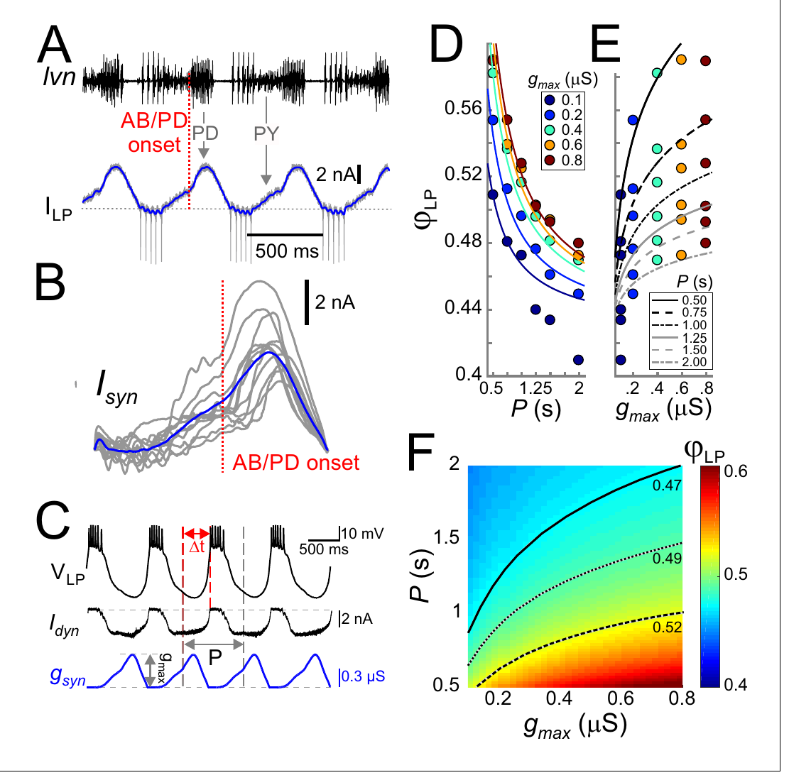
Dynamic clamp tests the timing effect of inhibition
Dynamic clamp injects an electrical current calculated from the recorded membrane voltage and a specified conductance. Martinez and colleagues used it to replace blocked input to a living LP neuron. The neuron’s own channels remained active while the experimenter controlled the inhibitory waveform.
The physiological synaptic waveform was measured in voltage-clamped LP and aligned to pacemaker burst onset. Replaying a conductance based on that waveform recruited LP bursts. Increasing imposed conductance delayed LP onset, whereas lengthening the repetition period tended to move onset to an earlier fraction of the cycle.
Opposing timing effects allow synaptic properties to compensate for changes in rhythm speed. The intervention tests the effect of a specified electrical input on a real neuron. It does not establish that the intact network naturally changes every waveform parameter in exactly the imposed manner.
Tang et al. (2010), Fig. 2(B). Crab pyloric circuit
Martinez et al. (2019), Fig. 3(A–F). Measured input, conductance replay and LP phase responses
Martinez et al. (2019); Tang et al. (2010)
24
Notes:
• Dynamic clamp injects an electrical current calculated from the recorded membrane voltage and a specified conductance. Martinez and colleagues used it to replace blocked input to a living LP neuron. The neuron’s own channels remained active while the experimenter controlled the inhibitory waveform.
– A conductance-based input changes current as the postsynaptic voltage changes, preserving a property that a fixed current pulse does not capture.
• The physiological synaptic waveform was measured in voltage-clamped LP and aligned to pacemaker burst onset. Replaying a conductance based on that waveform recruited LP bursts. Increasing imposed conductance delayed LP onset, whereas lengthening the repetition period tended to move onset to an earlier fraction of the cycle.
– The publication includes measured synaptic currents, replayed responses and phase measurements; these are distinct parts of the causal test.
• Opposing timing effects allow synaptic properties to compensate for changes in rhythm speed. The intervention tests the effect of a specified electrical input on a real neuron. It does not establish that the intact network naturally changes every waveform parameter in exactly the imposed manner.
– The amplitude of the synaptic conductance was measured in microsiemens, and the repetition period was measured in seconds.
References:
Martinez D, Anwar H, Bose A, Bucher DM, Nadim F. (2019). Short-term synaptic dynamics control the activity phase of neurons in an oscillatory network. eLife 8: e46911. https://doi.org/10.7554/elife.46911
Tang LS, Goeritz ML, Caplan JS, Taylor AL, Fisek M, Marder E. (2010). Precise temperature compensation of phase in a rhythmic motor pattern. PLoS Biology 8: e1000469. https://doi.org/10.1371/journal.pbio.1000469
Figure: Martinez et al. (2019), Fig. 3(A–F). Measured input, conductance replay and LP phase responses
Figure source: https://doi.org/10.7554/elife.46911
Figure: Tang et al. (2010), Fig. 2(B). Crab pyloric circuit
Figure source: https://doi.org/10.1371/journal.pbio.1000469

Slide 25
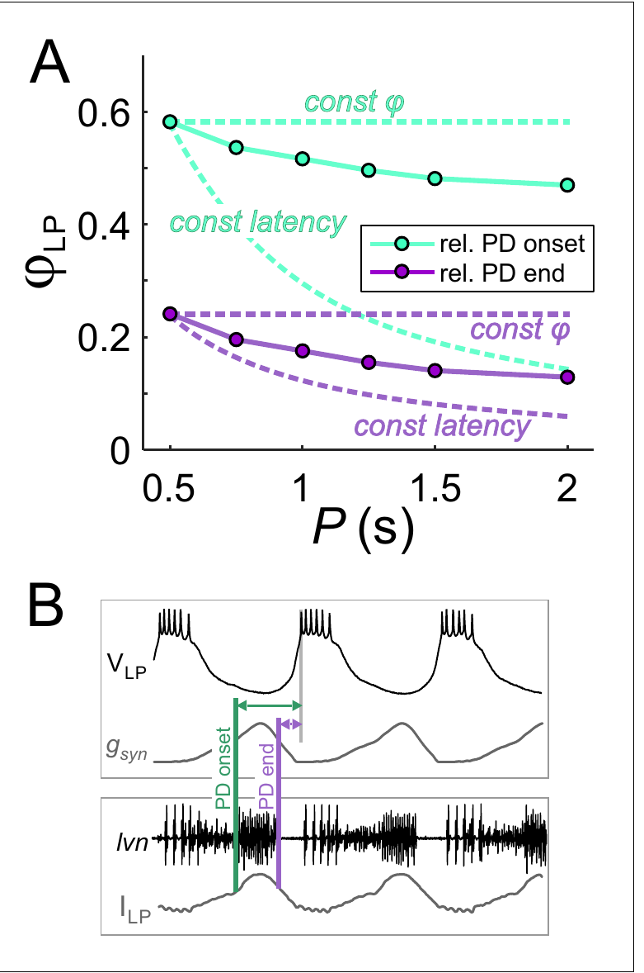
Inhibitory duty cycle contributes to phase control
Duty cycle is the fraction of a complete cycle occupied by an event. The duration of inhibition can remain a similar fraction of the pyloric cycle even as the absolute period changes. That relationship alters when an LP neuron is released from inhibition.
Martinez and colleagues compared LP onset phase measured from the start of the imposed pacemaker burst with onset measured from its end. The same bursts produced different phase-versus-period relationships under the two reference definitions. Their dynamic-clamp experiments also varied inhibitory duration independently of other waveform features.
Maintaining inhibitory duration proportional to period promoted phase maintenance more effectively than keeping duration fixed in milliseconds. The result concerns the timing of a controlled synaptic input. A stable motor phase can therefore emerge from coordinated input timing without requiring each neuron to retain a fixed absolute rebound latency.
Tang et al. (2010), Fig. 2(B). Crab pyloric circuit
Martinez et al. (2019), Fig. 4(A–B). LP phase depends on the timing reference and inhibitory duty cycle
Martinez et al. (2019); Tang et al. (2010)
25
Notes:
• Duty cycle is the fraction of a complete cycle occupied by an event. The duration of inhibition can remain a similar fraction of the pyloric cycle even as the absolute period changes. That relationship alters when an LP neuron is released from inhibition.
– The reference event must be stated whenever a phase is reported, because onset-relative and offset-relative phases describe different delays.
• Martinez and colleagues compared LP onset phase measured from the start of the imposed pacemaker burst with onset measured from its end. The same bursts produced different phase-versus-period relationships under the two reference definitions. Their dynamic-clamp experiments also varied inhibitory duration independently of other waveform features.
– The authors compared a fixed-duration condition of 300 ms with a fixed-duty-cycle condition occupying 0.3 of each cycle in their systematic waveform experiments.
• Maintaining inhibitory duration proportional to period promoted phase maintenance more effectively than keeping duration fixed in milliseconds. The result concerns the timing of a controlled synaptic input. A stable motor phase can therefore emerge from coordinated input timing without requiring each neuron to retain a fixed absolute rebound latency.
– Coordinating synaptic duration with period changes the time available for recovery from inhibition and for subsequent depolarization.
References:
Martinez D, Anwar H, Bose A, Bucher DM, Nadim F. (2019). Short-term synaptic dynamics control the activity phase of neurons in an oscillatory network. eLife 8: e46911. https://doi.org/10.7554/elife.46911
Tang LS, Goeritz ML, Caplan JS, Taylor AL, Fisek M, Marder E. (2010). Precise temperature compensation of phase in a rhythmic motor pattern. PLoS Biology 8: e1000469. https://doi.org/10.1371/journal.pbio.1000469
Figure: Martinez et al. (2019), Fig. 4(A–B). LP phase depends on the timing reference and inhibitory duty cycle
Figure source: https://doi.org/10.7554/elife.46911
Figure: Tang et al. (2010), Fig. 2(B). Crab pyloric circuit
Figure source: https://doi.org/10.1371/journal.pbio.1000469

Slide 26
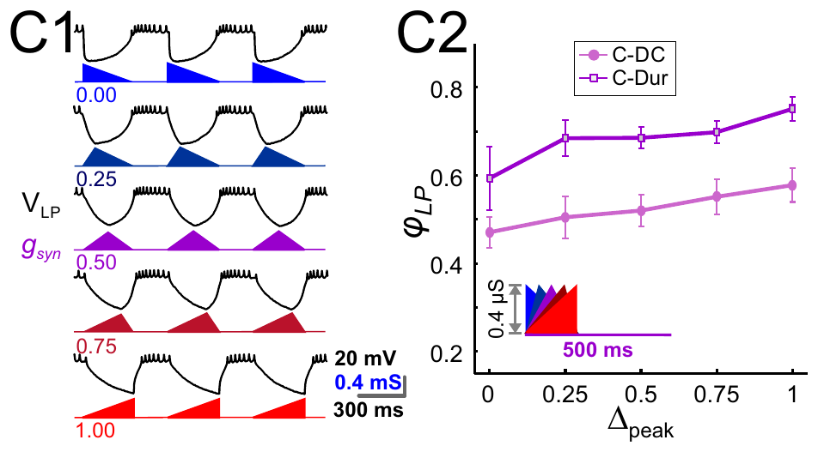
Later inhibitory peaks delay a follower’s activity
Martinez and colleagues varied the position of the peak within an imposed inhibitory conductance while keeping its period and amplitude controlled. A peak phase specifies when the conductance reaches its maximum within the active inhibitory interval. The waveform was delivered by dynamic clamp to a living LP neuron.
Moving the peak later shifted the onset of LP firing to a later pyloric phase. The published recording examples used a 500 ms period and compared several peak positions. They separated a change in inhibitory timing from a change in the neuron’s identity or its natural synaptic wiring.
Amplitude, duration and peak position can jointly influence release from inhibition. The authors’ mathematical analysis proposes how short-term synaptic depression could coordinate these features as period changes. The imposed-waveform recordings directly establish timing sensitivity; the proposed natural coordination requires a separate mechanistic inference.
Martinez et al. (2019), Fig. 6(C1–C2). Later inhibitory peaks delay LP activity in dynamic clamp
Tang et al. (2010), Fig. 2(B). Crab pyloric circuit
Martinez et al. (2019); Tang et al. (2010)
26
Notes:
• Martinez and colleagues varied the position of the peak within an imposed inhibitory conductance while keeping its period and amplitude controlled. A peak phase specifies when the conductance reaches its maximum within the active inhibitory interval. The waveform was delivered by dynamic clamp to a living LP neuron.
– Short-term synaptic depression is a transient reduction of a synapse’s efficacy during repeated activation, followed by recovery when activation is reduced.
• Moving the peak later shifted the onset of LP firing to a later pyloric phase. The published recording examples used a 500 ms period and compared several peak positions. They separated a change in inhibitory timing from a change in the neuron’s identity or its natural synaptic wiring.
– The input shapes are experimental conductances specified by the authors, and the voltage responses are recordings from the biological LP neuron.
• Amplitude, duration and peak position can jointly influence release from inhibition. The authors’ mathematical analysis proposes how short-term synaptic depression could coordinate these features as period changes. The imposed-waveform recordings directly establish timing sensitivity; the proposed natural coordination requires a separate mechanistic inference.
– The published inference about depression should be distinguished from an experiment that selectively blocks the molecular mechanism of depression in the intact circuit.
References:
Martinez D, Anwar H, Bose A, Bucher DM, Nadim F. (2019). Short-term synaptic dynamics control the activity phase of neurons in an oscillatory network. eLife 8: e46911. https://doi.org/10.7554/elife.46911
Tang LS, Goeritz ML, Caplan JS, Taylor AL, Fisek M, Marder E. (2010). Precise temperature compensation of phase in a rhythmic motor pattern. PLoS Biology 8: e1000469. https://doi.org/10.1371/journal.pbio.1000469
Figure: Martinez et al. (2019), Fig. 6(C1–C2). Later inhibitory peaks delay LP activity in dynamic clamp
Figure source: https://doi.org/10.7554/elife.46911
Figure: Tang et al. (2010), Fig. 2(B). Crab pyloric circuit
Figure source: https://doi.org/10.1371/journal.pbio.1000469

Slide 27
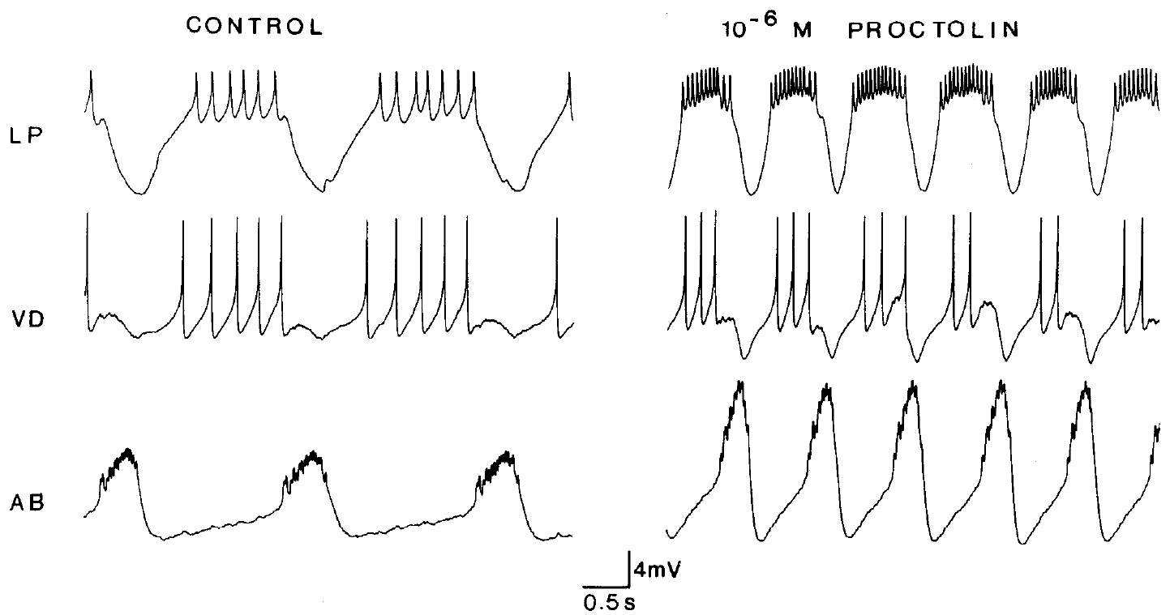
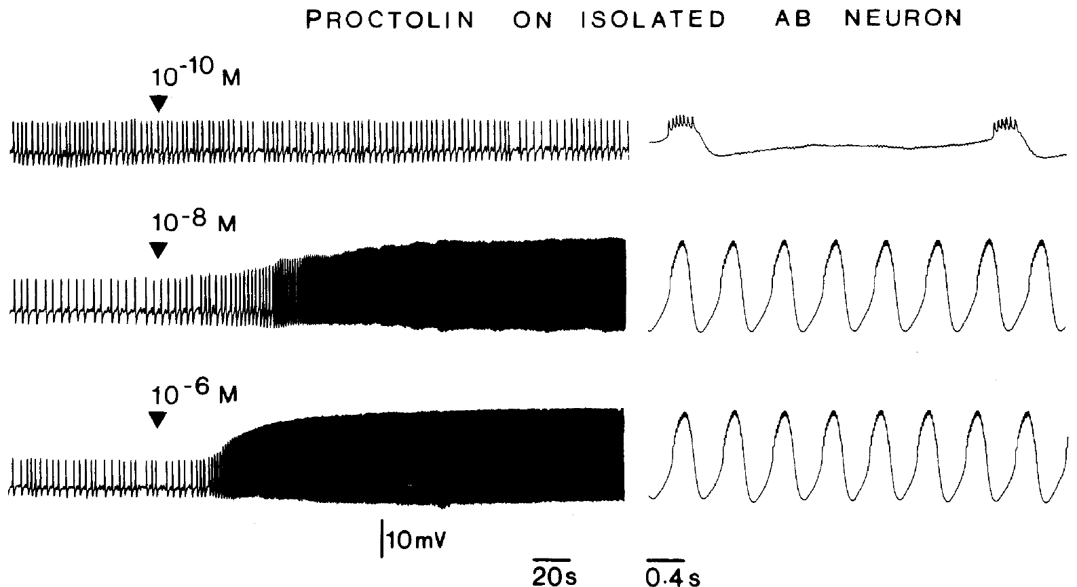
Proctolin changes the lobster pacemaker’s oscillation
Proctolin is a five-amino-acid neuropeptide that modulates the lobster pyloric circuit. Hooper and Marder applied it to the isolated stomatogastric preparation after descending input was blocked. Intracellular recordings separated slow membrane oscillations from the spikes generated during each depolarized phase.
At 1 μM proctolin, AB oscillation amplitude increased and follower-neuron activity changed. In isolated AB, progressively higher peptide concentrations recruited stronger activity. Saline wash between applications returned the neuron toward its baseline, providing a control for reversibility and persistent peptide effects.
The network response combined direct peptide actions on selected neurons with consequences propagated through their existing connections. Increased activity in a motor neuron did not by itself establish a direct receptor-mediated action on that cell. Isolation was required to distinguish a peptide target from a synaptic follower of another target.
Hooper & Marder (1987), Fig. 4. Proctolin changes AB oscillations and the activity of follower cells
Hooper & Marder (1987), Fig. 6. Proctolin excites the isolated AB neuron in a concentration-dependent manner
Hooper & Marder (1987)
27
Notes:
• Proctolin is a five-amino-acid neuropeptide that modulates the lobster pyloric circuit. Hooper and Marder applied it to the isolated stomatogastric preparation after descending input was blocked. Intracellular recordings separated slow membrane oscillations from the spikes generated during each depolarized phase.
– A peptide can alter a circuit without replacing its established synaptic connections or supplying a new rhythmic command on every cycle.
• At 1 μM proctolin, AB oscillation amplitude increased and follower-neuron activity changed. In isolated AB, progressively higher peptide concentrations recruited stronger activity. Saline wash between applications returned the neuron toward its baseline, providing a control for reversibility and persistent peptide effects.
– The isolated AB series included 0.1 nM, 10 nM and 1 μM applications, with at least 45 minutes of saline wash between tests.
• The network response combined direct peptide actions on selected neurons with consequences propagated through their existing connections. Increased activity in a motor neuron did not by itself establish a direct receptor-mediated action on that cell. Isolation was required to distinguish a peptide target from a synaptic follower of another target.
– The concentration-dependent response identifies a physiological action of proctolin; these recordings alone do not identify its receptor’s molecular sequence.
References:
Hooper SL, Marder E. (1987). Modulation of the lobster pyloric rhythm by the peptide proctolin. Journal of Neuroscience 7: 2097-2112. https://doi.org/10.1523/jneurosci.07-07-02097.1987
Figure: Hooper & Marder (1987), Fig. 4. Proctolin changes AB oscillations and the activity of follower cells
Figure source: https://doi.org/10.1523/jneurosci.07-07-02097.1987
Figure: Hooper & Marder (1987), Fig. 6. Proctolin excites the isolated AB neuron in a concentration-dependent manner
Figure source: https://doi.org/10.1523/jneurosci.07-07-02097.1987

Slide 28
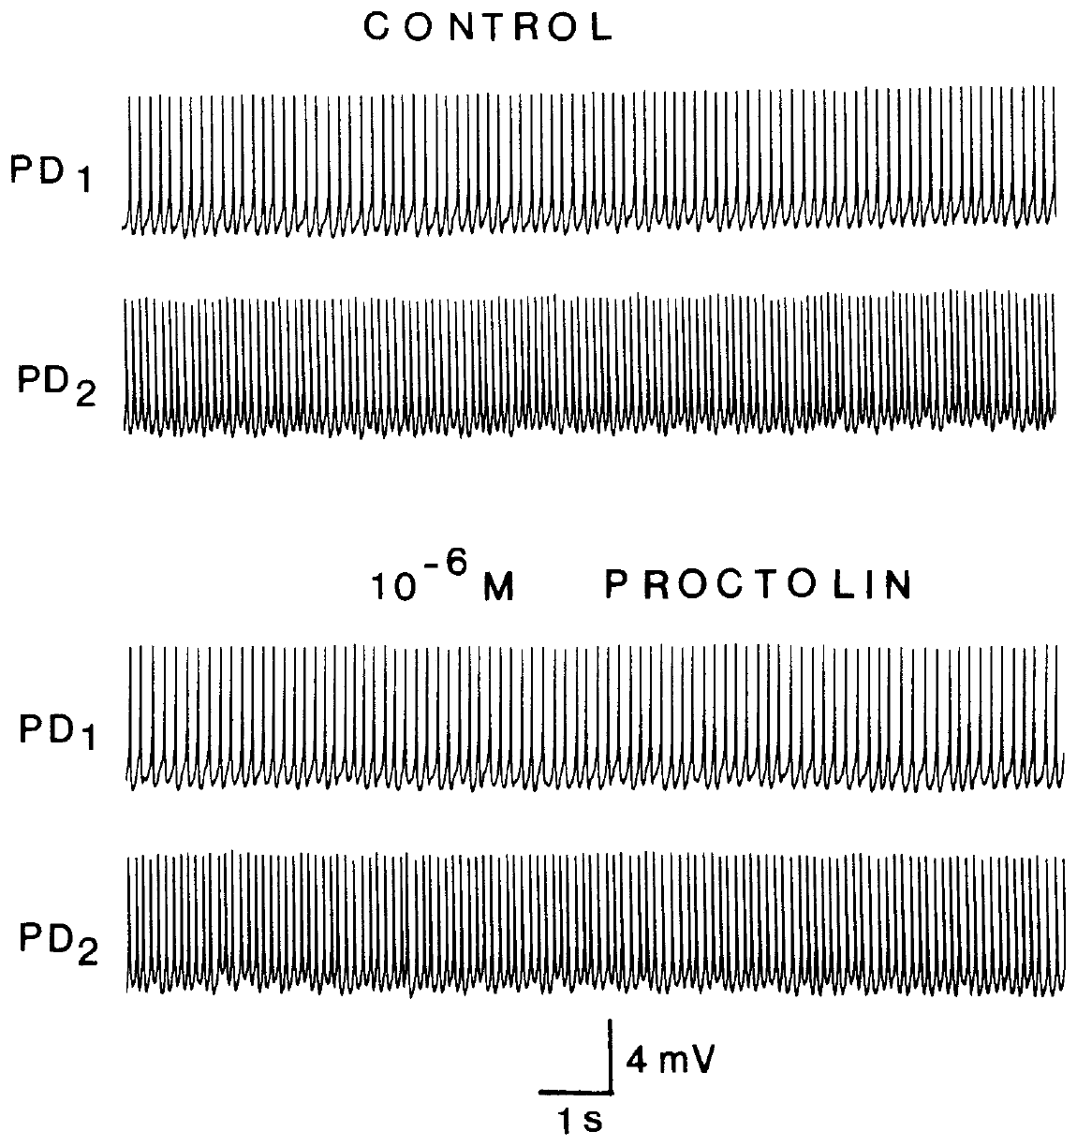
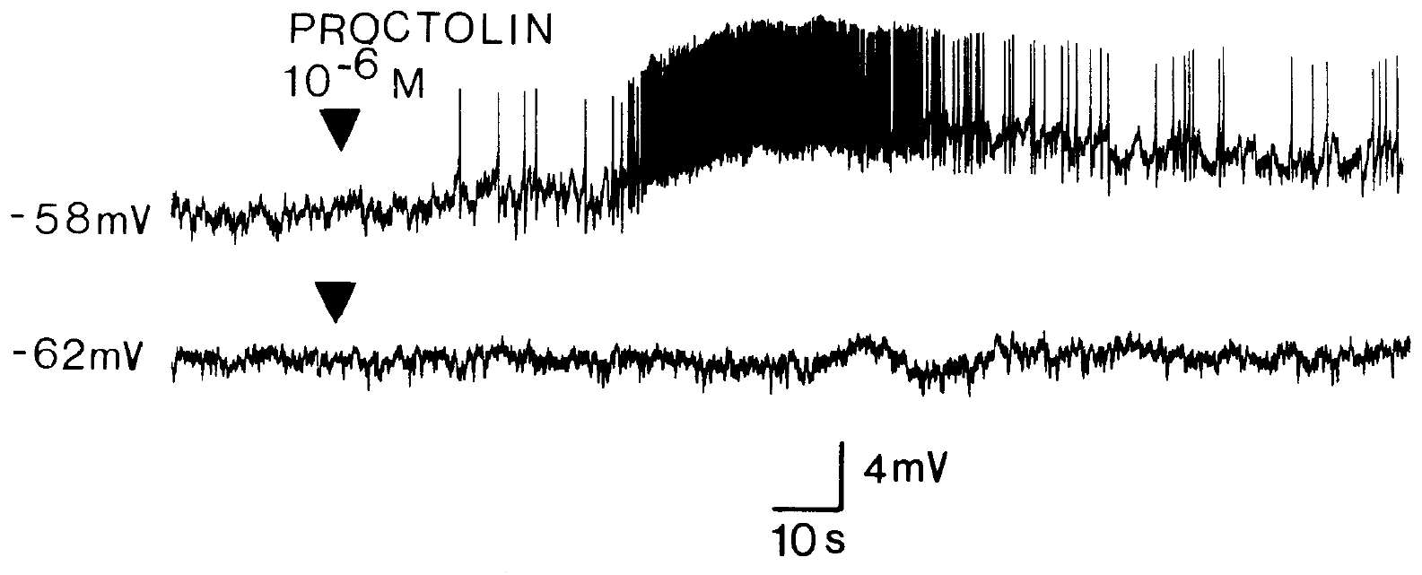
Direct peptide targets differ from affected motor cells
Hooper and Marder isolated lobster PD neurons from their major synaptic inputs, then applied 1 μM proctolin. The PD cells continued tonic firing without the direct peptide response found in isolated AB. In the intact circuit, however, PD activity changed because PD remained electrically coupled to the peptide-responsive AB neuron.
An isolated LP neuron responded differently depending on its membrane voltage. At approximately −58 mV, proctolin caused depolarization and spiking. At approximately −62 mV in the same neuron, that response was absent. Voltage-dependent expression of modulation can therefore obscure a response during a single baseline test.
A modulator’s circuit effect depends on target-cell properties and the connections transmitting their effects. Failure to respond in one voltage state does not prove that a neuron lacks a relevant receptor. Conversely, changed activity in the connected circuit does not prove that the modulator acts directly on that motor neuron.
Hooper & Marder (1987), Fig. 7. Isolated PD neurons retain tonic activity in proctolin
Hooper & Marder (1987), Fig. 9. The isolated LP response depends on membrane voltage
Hooper & Marder (1987)
28
Notes:
• Hooper and Marder isolated lobster PD neurons from their major synaptic inputs, then applied 1 μM proctolin. The PD cells continued tonic firing without the direct peptide response found in isolated AB. In the intact circuit, however, PD activity changed because PD remained electrically coupled to the peptide-responsive AB neuron.
– Electrical coupling provides a route by which an AB change affects PD even when isolated PD is insensitive to the tested proctolin application.
• An isolated LP neuron responded differently depending on its membrane voltage. At approximately −58 mV, proctolin caused depolarization and spiking. At approximately −62 mV in the same neuron, that response was absent. Voltage-dependent expression of modulation can therefore obscure a response during a single baseline test.
– Two electrodes allowed the experimenter to record LP voltage while using injected current to set its starting membrane potential.
• A modulator’s circuit effect depends on target-cell properties and the connections transmitting their effects. Failure to respond in one voltage state does not prove that a neuron lacks a relevant receptor. Conversely, changed activity in the connected circuit does not prove that the modulator acts directly on that motor neuron.
– The observed voltage dependence motivates tests over several membrane states; it does not establish a particular channel’s gating mechanism from these traces alone.
References:
Hooper SL, Marder E. (1987). Modulation of the lobster pyloric rhythm by the peptide proctolin. Journal of Neuroscience 7: 2097-2112. https://doi.org/10.1523/jneurosci.07-07-02097.1987
Figure: Hooper & Marder (1987), Fig. 7. Isolated PD neurons retain tonic activity in proctolin
Figure source: https://doi.org/10.1523/jneurosci.07-07-02097.1987
Figure: Hooper & Marder (1987), Fig. 9. The isolated LP response depends on membrane voltage
Figure source: https://doi.org/10.1523/jneurosci.07-07-02097.1987

Slide 29
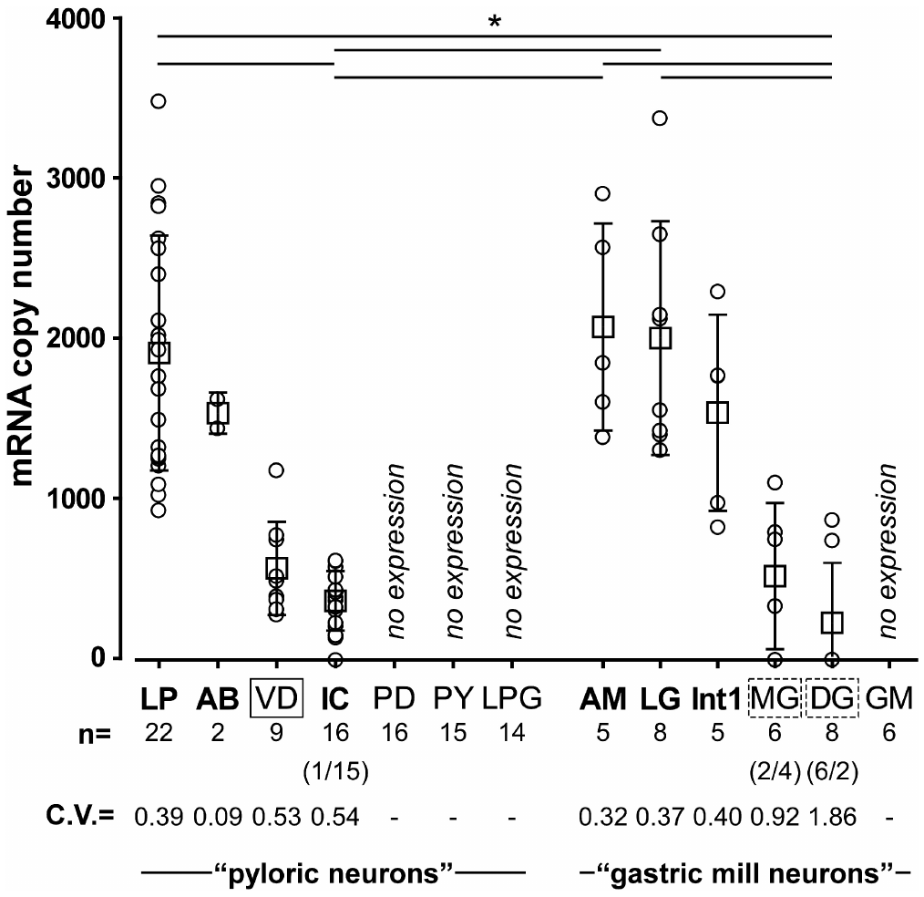
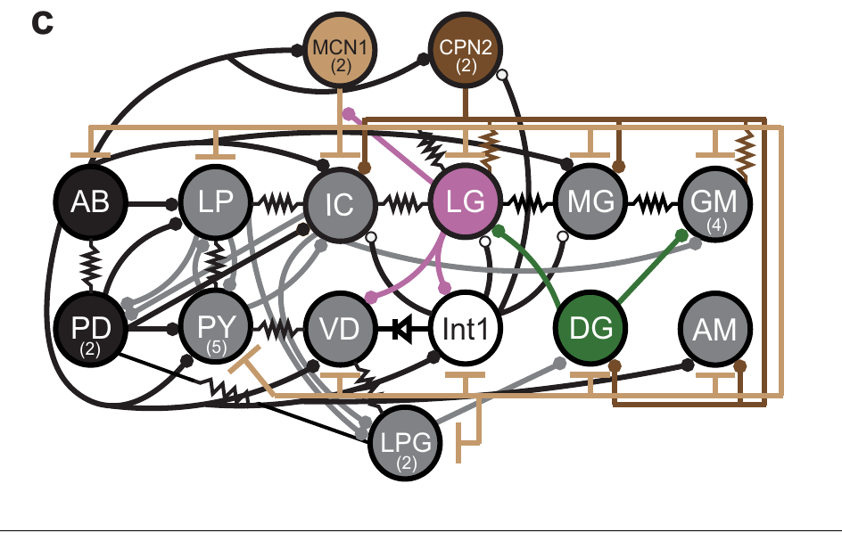
CCAP receptor transcripts differ among neuron classes
Garcia and colleagues identified a candidate CCAP receptor transcript in the crab nervous system. A transcript is an RNA copy of a gene used in protein production. The candidate sequence resembled known peptide receptors and predicted a receptor with seven membrane-spanning segments.
Single-cell quantitative PCR measured receptor RNA from individually identified neurons. PCR amplifies a selected nucleic-acid sequence so its abundance can be estimated. LP generally contained more receptor transcript than IC, while expression was low or undetectable in several other STG classes.
Transcript distribution broadly matched the cells in which CCAP activates I_MI. VD was an exception: receptor RNA was present without a detected current response. RNA abundance does not measure membrane receptor protein or identify every downstream effect of activation.
Powell et al. (2021), Fig. 1(c). Crab STG circuit
Garcia et al. (2015), Fig. 4. CCAP receptor transcript abundance differs across identified neurons
Garcia et al. (2015); Powell et al. (2021)
29
Notes:
• Garcia and colleagues identified a candidate CCAP receptor transcript in the crab nervous system. A transcript is an RNA copy of a gene used in protein production. The candidate sequence resembled known peptide receptors and predicted a receptor with seven membrane-spanning segments.
– The seven-segment topology and sequence similarity support a G-protein-coupled receptor candidate, rather than identifying a ligand-gated ion channel.
• Single-cell quantitative PCR measured receptor RNA from individually identified neurons. PCR amplifies a selected nucleic-acid sequence so its abundance can be estimated. LP generally contained more receptor transcript than IC, while expression was low or undetectable in several other STG classes.
– A G protein participates in intracellular signaling after receptor activation; those signaling steps can alter a different membrane protein that carries current.
• Transcript distribution broadly matched the cells in which CCAP activates IMI. VD was an exception: receptor RNA was present without a detected current response. RNA abundance does not measure membrane receptor protein or identify every downstream effect of activation.
– The transcript and physiological measurements are complementary, but the study did not equate each RNA molecule with one functional membrane receptor.
References:
Garcia VJ, Daur N, Temporal S, Schulz DJ, Bucher D. (2015). Neuropeptide receptor transcript expression levels and magnitude of ionic current responses show cell type-specific differences in a small motor circuit. Journal of Neuroscience 35: 6786-6800. https://doi.org/10.1523/jneurosci.0171-15.2015
Powell D, Haddad SA, Gorur-Shandilya S, Marder E. (2021). Coupling between fast and slow oscillator circuits in Cancer borealis is temperature-compensated. eLife 10: e60454. https://doi.org/10.7554/elife.60454
Figure: Garcia et al. (2015), Fig. 4. CCAP receptor transcript abundance differs across identified neurons
Figure source: https://doi.org/10.1523/jneurosci.0171-15.2015
Figure: Powell et al. (2021), Fig. 1(c). Crab STG circuit
Figure source: https://doi.org/10.7554/elife.60454

Slide 30
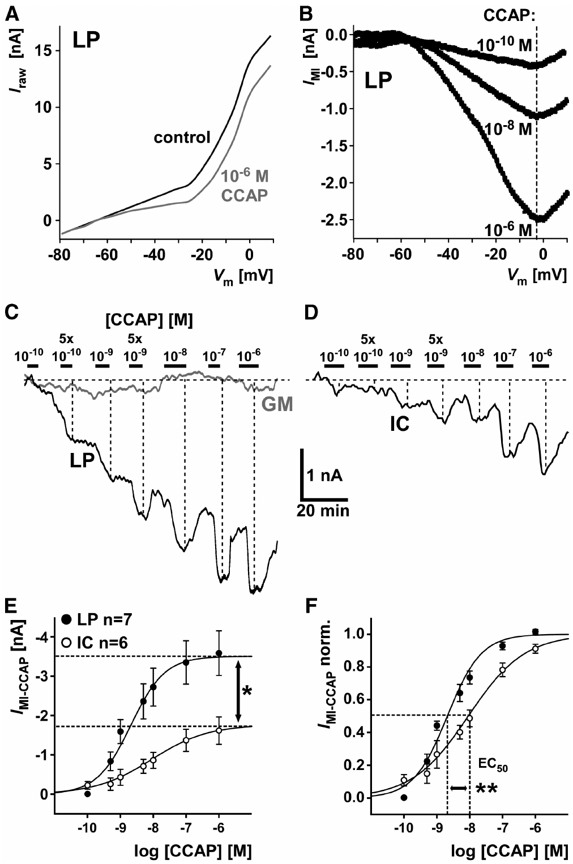
The same peptide produces different current responses
Garcia and colleagues voltage-clamped identified crab neurons while applying CCAP at controlled concentrations. They measured I_MI, a voltage-dependent modulator-activated inward current, by subtracting control currents from currents measured in peptide. LP and IC differed in both response magnitude and concentration dependence.
LP generated larger inward currents and responded more strongly at low concentrations than IC. Current measurements at −20 mV distinguished a cell’s concentration-response relationship from its spontaneous firing pattern. Increasing CCAP could saturate the response, so added peptide eventually produced little additional current.
Both cells possessed the capacity for peptide-activated inward current, yet the same bath concentration did not produce equivalent activation. Receptor abundance and access to downstream channel mechanisms are possible contributors. The physiological comparison does not establish a one-to-one conversion between receptor transcript count and current amplitude.
Powell et al. (2021), Fig. 1(c). Crab STG circuit
Garcia et al. (2015), Fig. 7(A–F). CCAP current amplitude and concentration dependence differ between LP and IC
Garcia et al. (2015); Powell et al. (2021)
30
Notes:
• Garcia and colleagues voltage-clamped identified crab neurons while applying CCAP at controlled concentrations. They measured IMI, a voltage-dependent modulator-activated inward current, by subtracting control currents from currents measured in peptide. LP and IC differed in both response magnitude and concentration dependence.
– Saturation means that increasing the ligand no longer increases the measured response substantially under the tested conditions.
• LP generated larger inward currents and responded more strongly at low concentrations than IC. Current measurements at −20 mV distinguished a cell’s concentration-response relationship from its spontaneous firing pattern. Increasing CCAP could saturate the response, so added peptide eventually produced little additional current.
– The current–voltage measurements retained the voltage dependence of the inward current, while the concentration series tested sensitivity to the ligand.
• Both cells possessed the capacity for peptide-activated inward current, yet the same bath concentration did not produce equivalent activation. Receptor abundance and access to downstream channel mechanisms are possible contributors. The physiological comparison does not establish a one-to-one conversion between receptor transcript count and current amplitude.
– The source’s receptor RNA comparison and current comparison support cell-specific modulation without defining the complete molecular composition of the I_MI channel.
References:
Garcia VJ, Daur N, Temporal S, Schulz DJ, Bucher D. (2015). Neuropeptide receptor transcript expression levels and magnitude of ionic current responses show cell type-specific differences in a small motor circuit. Journal of Neuroscience 35: 6786-6800. https://doi.org/10.1523/jneurosci.0171-15.2015
Powell D, Haddad SA, Gorur-Shandilya S, Marder E. (2021). Coupling between fast and slow oscillator circuits in Cancer borealis is temperature-compensated. eLife 10: e60454. https://doi.org/10.7554/elife.60454
Figure: Garcia et al. (2015), Fig. 7(A–F). CCAP current amplitude and concentration dependence differ between LP and IC
Figure source: https://doi.org/10.1523/jneurosci.0171-15.2015
Figure: Powell et al. (2021), Fig. 1(c). Crab STG circuit
Figure source: https://doi.org/10.7554/elife.60454

Slide 31
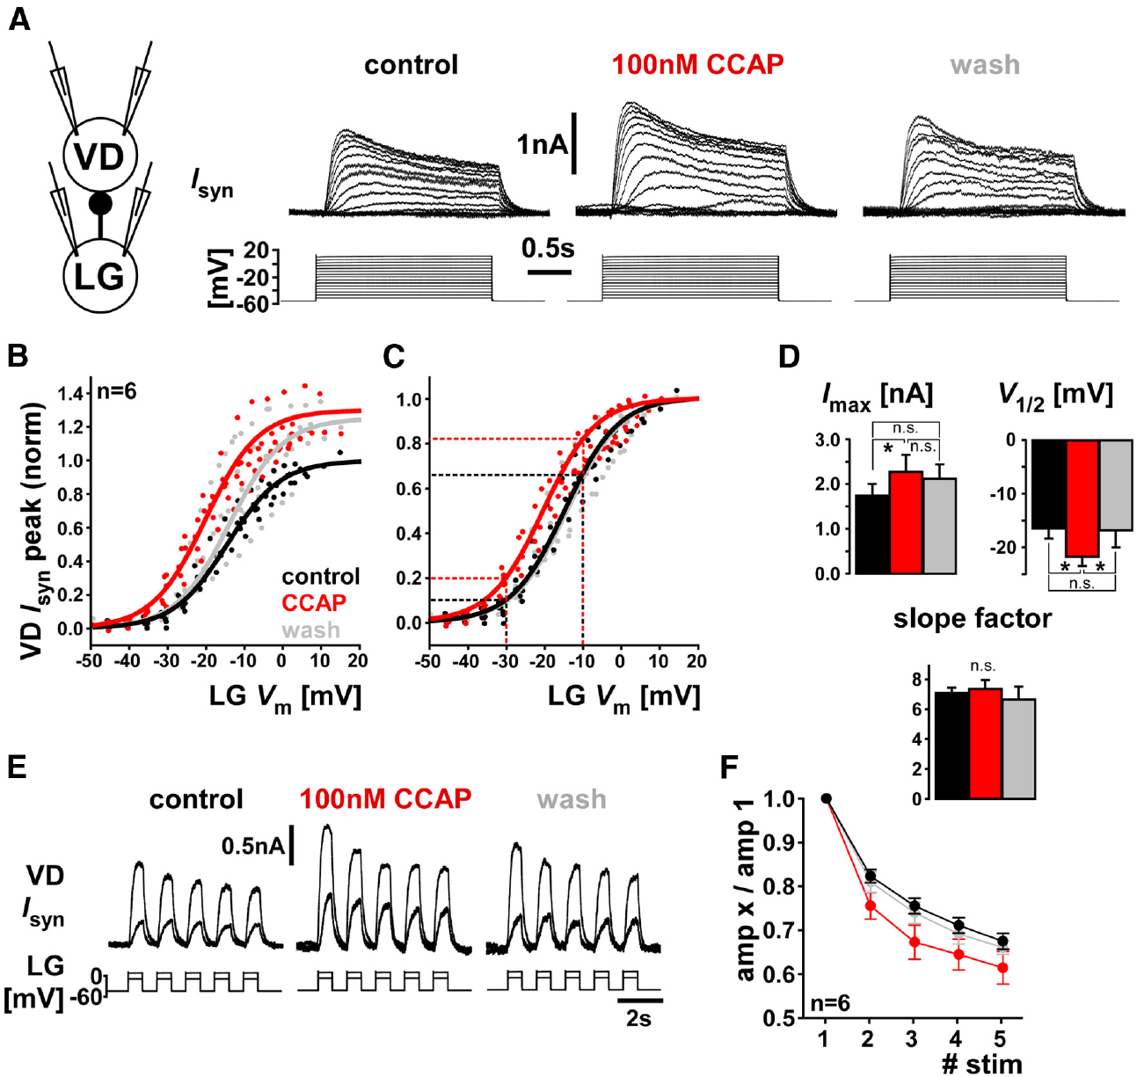
CCAP can modulate a synapse without activating I_MI
The crab VD neuron expressed candidate CCAP receptor RNA but lacked a detected CCAP-induced I_MI response. Garcia and colleagues tested a different physiological endpoint: the graded inhibitory synapse from VD to the lateral gastric neuron, LG, a motor neuron participating in the gastric mill rhythm.
VD voltage steps evoked postsynaptic current in voltage-clamped LG. Application of 100 nM CCAP strengthened this response, and washout returned it toward control. The comparison measured the same synapse under controlled presynaptic and postsynaptic voltages, rather than inferring synaptic strength from uncontrolled spike counts.
A peptide receptor can influence synaptic transmission even when one particular intrinsic current is absent. The VD result resolves an apparent mismatch between transcript expression and I_MI response. It does not establish that receptor activation follows identical intracellular signaling steps in VD, LP and IC.
Garcia et al. (2015), Fig. 5(A–F). CCAP strengthens graded transmission and changes short-term synaptic dynamics
Garcia et al. (2015)
31
Notes:
• The crab VD neuron expressed candidate CCAP receptor RNA but lacked a detected CCAP-induced IMI response. Garcia and colleagues tested a different physiological endpoint: the graded inhibitory synapse from VD to the lateral gastric neuron, LG, a motor neuron participating in the gastric mill rhythm.
– The lateral gastric motor neuron is associated with the protraction component of the gastric mill rhythm, and receives input from neurons shared with other motor patterns.
• VD voltage steps evoked postsynaptic current in voltage-clamped LG. Application of 100 nM CCAP strengthened this response, and washout returned it toward control. The comparison measured the same synapse under controlled presynaptic and postsynaptic voltages, rather than inferring synaptic strength from uncontrolled spike counts.
– The publication measured graded synaptic current across presynaptic voltage steps and during an imposed waveform, separating voltage-dependent release from natural circuit firing.
• A peptide receptor can influence synaptic transmission even when one particular intrinsic current is absent. The VD result resolves an apparent mismatch between transcript expression and IMI response. It does not establish that receptor activation follows identical intracellular signaling steps in VD, LP and IC.
– A negative result for one current assay should not be treated as a negative result for every form of modulation in that cell.
References:
Garcia VJ, Daur N, Temporal S, Schulz DJ, Bucher D. (2015). Neuropeptide receptor transcript expression levels and magnitude of ionic current responses show cell type-specific differences in a small motor circuit. Journal of Neuroscience 35: 6786-6800. https://doi.org/10.1523/jneurosci.0171-15.2015
Figure: Garcia et al. (2015), Fig. 5(A–F). CCAP strengthens graded transmission and changes short-term synaptic dynamics
Figure source: https://doi.org/10.1523/jneurosci.0171-15.2015

Slide 32
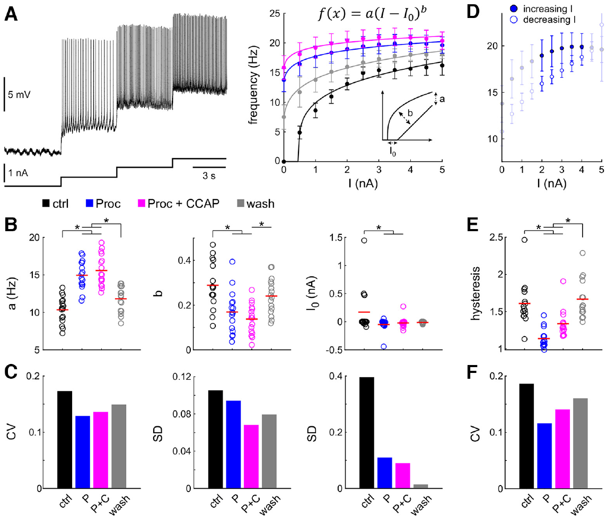
Modulators change excitability and reduce output variation
Excitability describes how readily a neuron generates action potentials in response to input. Schneider and colleagues isolated the crab LP neuron pharmacologically, then injected progressively larger depolarizing currents. The resulting firing-rate relationship was measured in control saline, proctolin, proctolin plus CCAP and wash.
Proctolin shifted the relationship so LP began firing at lower injected current. Adding CCAP further altered its output. Comparisons across animals found that neuronal firing responses became more similar in modulators, even though the underlying measured intrinsic and synaptic currents remained variable.
Interindividual variability means differences among animals of the same species. Neuromodulation can constrain that variability at the level of output without making every cellular parameter identical. The result concerns responses of isolated LP to controlled current, rather than all dimensions of the intact pyloric motor pattern.
Tang et al. (2010), Fig. 2(B). Crab pyloric circuit
Schneider et al. (2022), Fig. 3(A–F). Proctolin and CCAP change LP excitability and output variability
Schneider et al. (2022); Tang et al. (2010)
32
Notes:
• Excitability describes how readily a neuron generates action potentials in response to input. Schneider and colleagues isolated the crab LP neuron pharmacologically, then injected progressively larger depolarizing currents. The resulting firing-rate relationship was measured in control saline, proctolin, proctolin plus CCAP and wash.
– The firing-rate–current relationship measures spikes per second at a specified current in nanoamperes, making input and output explicit.
• Proctolin shifted the relationship so LP began firing at lower injected current. Adding CCAP further altered its output. Comparisons across animals found that neuronal firing responses became more similar in modulators, even though the underlying measured intrinsic and synaptic currents remained variable.
– The test included 1 μM proctolin and 1 μM CCAP, with wash recordings used to assess the reversibility of modulation.
• Interindividual variability means differences among animals of the same species. Neuromodulation can constrain that variability at the level of output without making every cellular parameter identical. The result concerns responses of isolated LP to controlled current, rather than all dimensions of the intact pyloric motor pattern.
– Similar activity can arise in neurons with different current magnitudes because output depends on the interaction of currents over the neuron’s operating voltage range.
References:
Schneider AC, Itani O, Bucher D, Nadim F. (2022). Neuromodulation Reduces Interindividual Variability of Neuronal Output. eNeuro 9: ENEURO.0166-22.2022. https://doi.org/10.1523/eneuro.0166-22.2022
Tang LS, Goeritz ML, Caplan JS, Taylor AL, Fisek M, Marder E. (2010). Precise temperature compensation of phase in a rhythmic motor pattern. PLoS Biology 8: e1000469. https://doi.org/10.1371/journal.pbio.1000469
Figure: Schneider et al. (2022), Fig. 3(A–F). Proctolin and CCAP change LP excitability and output variability
Figure source: https://doi.org/10.1523/eneuro.0166-22.2022
Figure: Tang et al. (2010), Fig. 2(B). Crab pyloric circuit
Figure source: https://doi.org/10.1371/journal.pbio.1000469

Slide 33
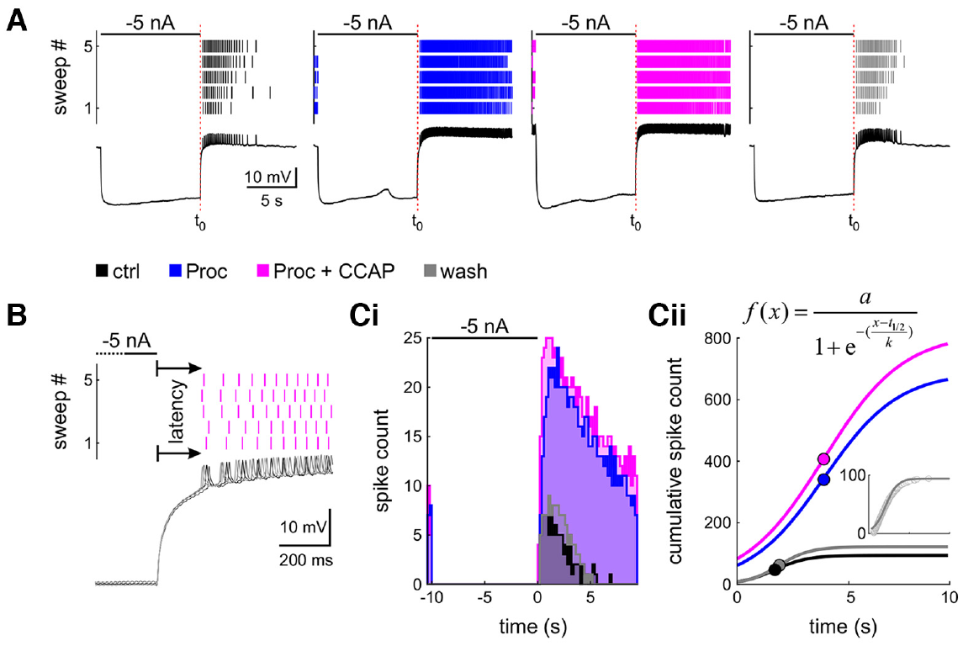
Peptide state changes rebound after inhibition
Postinhibitory rebound is renewed depolarization or firing after an inhibitory episode ends. Schneider and colleagues tested it in isolated crab LP neurons with a 5 s hyperpolarizing current pulse of −5 nA. Recording continued after release to measure the first spike and subsequent firing.
Proctolin and proctolin plus CCAP shortened rebound latency and increased spike output relative to control saline. The recordings compared identical imposed inhibitory pulses across modulatory conditions. Across animals, several rebound-output differences became smaller in the peptide states.
The same neuron can therefore resume firing differently after the same inhibition when its modulatory state changes. Rebound is an interaction between prior voltage history and active membrane currents, rather than a fixed delay assigned to a cell type. The experiments do not isolate one current as the sole source of rebound.
Schneider et al. (2022), Fig. 4(A–C). Modulators alter LP rebound latency and subsequent firing
Tang et al. (2010), Fig. 2(B). Crab pyloric circuit
Schneider et al. (2022); Tang et al. (2010)
33
Notes:
• Postinhibitory rebound is renewed depolarization or firing after an inhibitory episode ends. Schneider and colleagues tested it in isolated crab LP neurons with a 5 s hyperpolarizing current pulse of −5 nA. Recording continued after release to measure the first spike and subsequent firing.
– The neuron’s voltage during inhibition changes the availability of voltage-dependent channels before the pulse ends.
• Proctolin and proctolin plus CCAP shortened rebound latency and increased spike output relative to control saline. The recordings compared identical imposed inhibitory pulses across modulatory conditions. Across animals, several rebound-output differences became smaller in the peptide states.
– Rebound latency was measured from the end of the imposed inhibitory current to the first detected action potential, not from the beginning of the pulse.
• The same neuron can therefore resume firing differently after the same inhibition when its modulatory state changes. Rebound is an interaction between prior voltage history and active membrane currents, rather than a fixed delay assigned to a cell type. The experiments do not isolate one current as the sole source of rebound.
– The wash condition checked the persistence of the altered response after peptide removal.
References:
Schneider AC, Itani O, Bucher D, Nadim F. (2022). Neuromodulation Reduces Interindividual Variability of Neuronal Output. eNeuro 9: ENEURO.0166-22.2022. https://doi.org/10.1523/eneuro.0166-22.2022
Tang LS, Goeritz ML, Caplan JS, Taylor AL, Fisek M, Marder E. (2010). Precise temperature compensation of phase in a rhythmic motor pattern. PLoS Biology 8: e1000469. https://doi.org/10.1371/journal.pbio.1000469
Figure: Schneider et al. (2022), Fig. 4(A–C). Modulators alter LP rebound latency and subsequent firing
Figure source: https://doi.org/10.1523/eneuro.0166-22.2022
Figure: Tang et al. (2010), Fig. 2(B). Crab pyloric circuit
Figure source: https://doi.org/10.1371/journal.pbio.1000469

Slide 34
Gastric mill activity alternates protraction and retraction
The crab gastric mill rhythm organizes chewing movements through alternating phases. LG participates in protraction, movement of the gastric teeth toward the chewing configuration, whereas other gastric motor neurons are associated with retraction, their return movement. The slower gastric rhythm interacts with the fast pyloric rhythm.
Powell and colleagues recorded activity from identified gastric and pyloric motor nerves. Gastric activity included alternating LG and dorsal gastric, or DG, bursts, while PD continued its faster rhythm. Intracellular recordings linked LG activity to the inhibitory gastric interneuron Int1, meaning interneuron 1.
LG and Int1 participate in a half-center, a reciprocally inhibitory arrangement in which activity in each member inhibits the other. That arrangement helps organize alternation but does not, by itself, establish sustained rhythm generation in every input state. Descending modulation supplies additional conditions for gastric activity.
Powell et al. (2021), Fig. 1(a–d). Gastric and pyloric circuits and their recorded interaction
Powell et al. (2021)
34
Notes:
• The crab gastric mill rhythm organizes chewing movements through alternating phases. LG participates in protraction, movement of the gastric teeth toward the chewing configuration, whereas other gastric motor neurons are associated with retraction, their return movement. The slower gastric rhythm interacts with the fast pyloric rhythm.
– LG and DG are gastric motor neurons, whereas Int1 is an interneuron within the central gastric circuit.
• Powell and colleagues recorded activity from identified gastric and pyloric motor nerves. Gastric activity included alternating LG and dorsal gastric, or DG, bursts, while PD continued its faster rhythm. Intracellular recordings linked LG activity to the inhibitory gastric interneuron Int1, meaning interneuron 1.
– Reciprocal inhibition means that each partner supplies inhibition to the other; the active partner suppresses its antagonist during its burst.
• LG and Int1 participate in a half-center, a reciprocally inhibitory arrangement in which activity in each member inhibits the other. That arrangement helps organize alternation but does not, by itself, establish sustained rhythm generation in every input state. Descending modulation supplies additional conditions for gastric activity.
– The slow rhythm operates near 0.1 Hz in the preparations discussed by Powell and colleagues, while the pyloric rhythm operates near 1 Hz.
References:
Powell D, Haddad SA, Gorur-Shandilya S, Marder E. (2021). Coupling between fast and slow oscillator circuits in Cancer borealis is temperature-compensated. eLife 10: e60454. https://doi.org/10.7554/elife.60454
Figure: Powell et al. (2021), Fig. 1(a–d). Gastric and pyloric circuits and their recorded interaction
Figure source: https://doi.org/10.7554/elife.60454

Slide 35
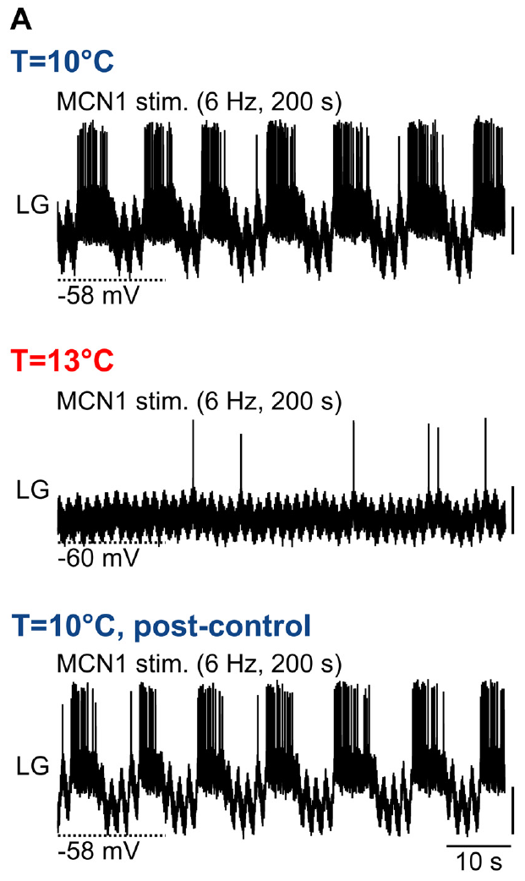
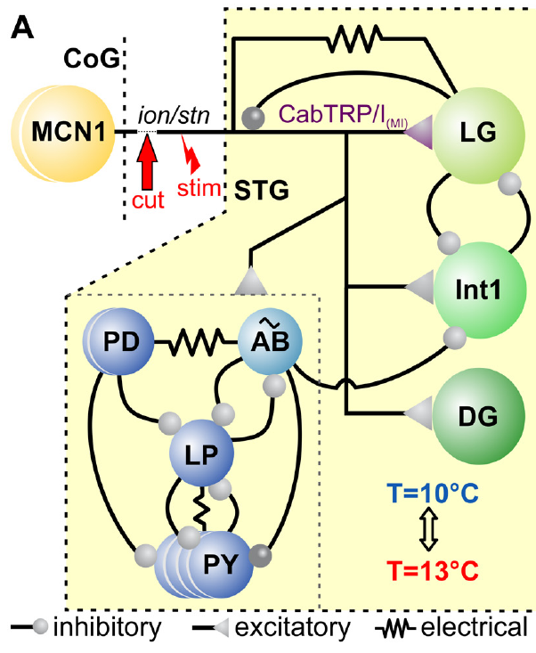
Descending MCN1 input recruits the gastric half-center
Modulatory commissural neuron 1 (MCN1) is a descending projection neuron whose cell body lies in a commissural ganglion. Its axon reaches the crab STG through the input nerves. Städele and colleagues controlled this input by stimulating the identified pathway after disconnecting other anterior influences.
MCN1 releases the peptide CabTRP Ia, which activates an inward current in LG, and also supplies electrical and other synaptic influences within the gastric circuit. LG and Int1 inhibit one another. Rhythmic alternation therefore depends on a combination of imposed modulatory drive, intrinsic membrane properties and reciprocal inhibition.
At 10°C, continuous MCN1 stimulation at 6 Hz recruited recurring LG bursts in the published example. The stimulus itself was tonic, rather than patterned to match every LG burst. Slow gastric rhythmicity was thus generated by the responding circuit under sustained descending activation.
Städele et al. (2015), Fig. 1(A). Gastric circuit
Städele et al. (2015), Fig. 2(A). Fixed 6 Hz MCN1 drive fails at 13°C and recovers after cooling
Städele et al. (2015)
35
Notes:
• Modulatory commissural neuron 1 (MCN1) is a descending projection neuron whose cell body lies in a commissural ganglion. Its axon reaches the crab STG through the input nerves. Städele and colleagues controlled this input by stimulating the identified pathway after disconnecting other anterior influences.
– A projection neuron sends an axon from one ganglion into another and can provide a modulatory state rather than a precisely timed command for every contraction.
• MCN1 releases the peptide CabTRP Ia, which activates an inward current in LG, and also supplies electrical and other synaptic influences within the gastric circuit. LG and Int1 inhibit one another. Rhythmic alternation therefore depends on a combination of imposed modulatory drive, intrinsic membrane properties and reciprocal inhibition.
– LG inhibits MCN1 terminals during its active phase, so a constant axonal stimulus does not guarantee constant effective peptide influence throughout the gastric cycle.
• At 10°C, continuous MCN1 stimulation at 6 Hz recruited recurring LG bursts in the published example. The stimulus itself was tonic, rather than patterned to match every LG burst. Slow gastric rhythmicity was thus generated by the responding circuit under sustained descending activation.
– The controlled stimulation establishes a defined gastric-rhythm state; naturally recruited gastric rhythms can receive additional descending and sensory inputs.
References:
Städele C, Heigele S, Stein W. (2015). Neuromodulation to the Rescue: Compensation of Temperature-Induced Breakdown of Rhythmic Motor Patterns via Extrinsic Neuromodulatory Input. PLoS Biology 13: e1002265. https://doi.org/10.1371/journal.pbio.1002265
Figure: Städele et al. (2015), Fig. 2(A). Fixed 6 Hz MCN1 drive fails at 13°C and recovers after cooling
Figure source: https://doi.org/10.1371/journal.pbio.1002265
Figure: Städele et al. (2015), Fig. 1(A). Gastric circuit
Figure source: https://doi.org/10.1371/journal.pbio.1002265

Slide 36
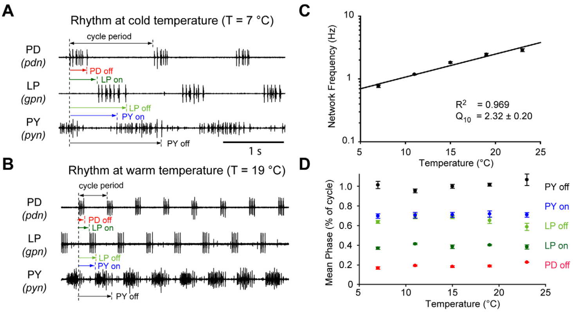
Warming speeds the pyloric rhythm about fourfold
Tang and colleagues tested the crab pyloric circuit over a temperature range relevant to an ectothermic animal. An ectotherm relies substantially on environmental conditions to determine body temperature. The isolated stomatogastric preparation was warmed gradually while outgoing motor activity was recorded.
Between 7°C and 23°C, pyloric rhythm frequency increased about fourfold. PD, LP and PY retained the characteristic burst sequence while completing cycles more quickly. Comparisons during warming and cooling checked whether the relationship depended on the direction of temperature change.
The reported frequency temperature coefficient, Q10, was approximately 2.3; Q10 describes the fold change associated with a 10°C increase. Temperature compensation need not mean a constant frequency. Different output properties can remain coordinated even when the entire motor pattern accelerates.
Tang et al. (2010), Fig. 1(A–D). Frequency increases while pyloric phase remains stable
Tang et al. (2010), Fig. 2(B). Crab pyloric circuit
Tang et al. (2010)
36
Notes:
• Tang and colleagues tested the crab pyloric circuit over a temperature range relevant to an ectothermic animal. An ectotherm relies substantially on environmental conditions to determine body temperature. The isolated stomatogastric preparation was warmed gradually while outgoing motor activity was recorded.
– The nerve recordings measure central motor commands in a preparation with its normal anterior modulatory connections retained.
• Between 7°C and 23°C, pyloric rhythm frequency increased about fourfold. PD, LP and PY retained the characteristic burst sequence while completing cycles more quickly. Comparisons during warming and cooling checked whether the relationship depended on the direction of temperature change.
– The recorded sequence persisted even though the absolute intervals separating successive bursts became shorter.
• The reported frequency temperature coefficient, Q10, was approximately 2.3; Q10 describes the fold change associated with a 10°C increase. Temperature compensation need not mean a constant frequency. Different output properties can remain coordinated even when the entire motor pattern accelerates.
– The observed frequency increase should be distinguished from a mechanism that holds a circadian period constant across temperature.
References:
Tang LS, Goeritz ML, Caplan JS, Taylor AL, Fisek M, Marder E. (2010). Precise temperature compensation of phase in a rhythmic motor pattern. PLoS Biology 8: e1000469. https://doi.org/10.1371/journal.pbio.1000469
Figure: Tang et al. (2010), Fig. 1(A–D). Frequency increases while pyloric phase remains stable
Figure source: https://doi.org/10.1371/journal.pbio.1000469
Figure: Tang et al. (2010), Fig. 2(B). Crab pyloric circuit
Figure source: https://doi.org/10.1371/journal.pbio.1000469

Slide 37
Relative burst timing remains stable during warming
Tang and colleagues measured each motor burst relative to the start of the PD burst. The onset phase specifies when a burst begins within a cycle, and the offset phase specifies when it ends. These fractions distinguish relative coordination from absolute delays measured in seconds.
Across 7°C to 23°C, PD, LP and PY onset and offset phases remained nearly constant despite the increase in frequency. When intracellular voltage trajectories were scaled to cycle duration, their characteristic temporal relationships also remained similar across the tested temperatures.
The pyloric circuit therefore compensated the coordination of its motor output more closely than its speed. Stability of phase does not imply that every underlying conductance was temperature-invariant. The neuron’s membrane currents and synaptic input could change while their combined effect preserved the sequence.
Tang et al. (2010), Fig. 1(A–D). Frequency increases while pyloric phase remains stable
Tang et al. (2010), Fig. 2(B). Crab pyloric circuit
Tang et al. (2010)
37
Notes:
• Tang and colleagues measured each motor burst relative to the start of the PD burst. The onset phase specifies when a burst begins within a cycle, and the offset phase specifies when it ends. These fractions distinguish relative coordination from absolute delays measured in seconds.
– The phase reference was the beginning of the PD burst, which is assigned the start of the pyloric cycle.
• Across 7°C to 23°C, PD, LP and PY onset and offset phases remained nearly constant despite the increase in frequency. When intracellular voltage trajectories were scaled to cycle duration, their characteristic temporal relationships also remained similar across the tested temperatures.
– A shorter delay in seconds can occupy the same fraction of a shorter cycle, so unchanged phase and increased frequency are compatible observations.
• The pyloric circuit therefore compensated the coordination of its motor output more closely than its speed. Stability of phase does not imply that every underlying conductance was temperature-invariant. The neuron’s membrane currents and synaptic input could change while their combined effect preserved the sequence.
– The intracellular trajectories were normalized by cycle duration; their alignment tests whether relative voltage timing persists as the cycles become faster.
References:
Tang LS, Goeritz ML, Caplan JS, Taylor AL, Fisek M, Marder E. (2010). Precise temperature compensation of phase in a rhythmic motor pattern. PLoS Biology 8: e1000469. https://doi.org/10.1371/journal.pbio.1000469
Figure: Tang et al. (2010), Fig. 1(A–D). Frequency increases while pyloric phase remains stable
Figure source: https://doi.org/10.1371/journal.pbio.1000469
Figure: Tang et al. (2010), Fig. 2(B). Crab pyloric circuit
Figure source: https://doi.org/10.1371/journal.pbio.1000469

Slide 38
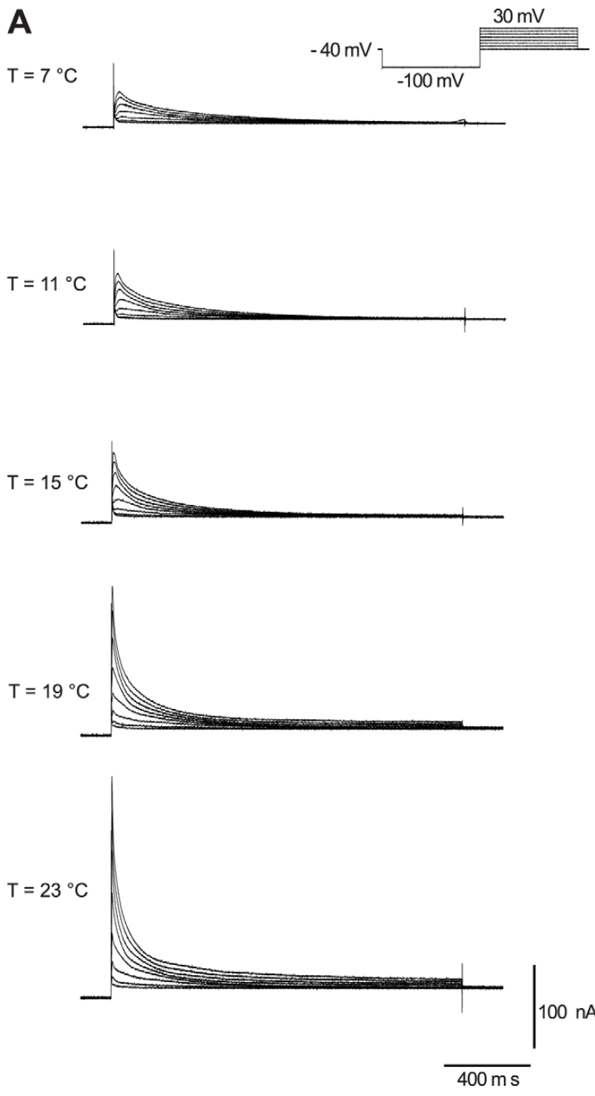
A transient potassium current opposes depolarization
The LP neuron contains the A-type potassium current, I_A, which activates during depolarization and then declines. Activation increases channel opening; inactivation reduces channel availability despite continuing depolarization. This transient outward current can oppose the return to firing after inhibition.
Tang and colleagues isolated I_A with voltage-clamp protocols that separated it from other potassium currents. Depolarizing test steps from −40 mV to +30 mV elicited transient currents at temperatures from 7°C to 23°C. The published families of currents use 100 nA and 400 ms calibrations.
Warming increased current magnitude and accelerated its activation and inactivation. A change in amplitude alone therefore does not predict its effect on burst delay; a stronger transient current may also disappear sooner. The measurements identify temperature-sensitive current behavior without proving that I_A alone maintains LP phase.
Tang et al. (2010), Fig. 2(B). Crab pyloric circuit
Tang et al. (2010), Fig. 4(A). Transient potassium-current recordings at five temperatures
Tang et al. (2010)
38
Notes:
• The LP neuron contains the A-type potassium current, IA, which activates during depolarization and then declines. Activation increases channel opening; inactivation reduces channel availability despite continuing depolarization. This transient outward current can oppose the return to firing after inhibition.
– Potassium current is outward over the tested depolarized range, carrying a voltage influence that opposes excitation.
• Tang and colleagues isolated IA with voltage-clamp protocols that separated it from other potassium currents. Depolarizing test steps from −40 mV to +30 mV elicited transient currents at temperatures from 7°C to 23°C. The published families of currents use 100 nA and 400 ms calibrations.
– Voltage clamp allows the current to be measured at controlled membrane voltages instead of inferring it from a changing burst waveform.
• Warming increased current magnitude and accelerated its activation and inactivation. A change in amplitude alone therefore does not predict its effect on burst delay; a stronger transient current may also disappear sooner. The measurements identify temperature-sensitive current behavior without proving that IA alone maintains LP phase.
– The time course matters because the inhibition preceding LP firing changes which channels are available when excitation resumes.
References:
Tang LS, Goeritz ML, Caplan JS, Taylor AL, Fisek M, Marder E. (2010). Precise temperature compensation of phase in a rhythmic motor pattern. PLoS Biology 8: e1000469. https://doi.org/10.1371/journal.pbio.1000469
Figure: Tang et al. (2010), Fig. 4(A). Transient potassium-current recordings at five temperatures
Figure source: https://doi.org/10.1371/journal.pbio.1000469
Figure: Tang et al. (2010), Fig. 2(B). Crab pyloric circuit
Figure source: https://doi.org/10.1371/journal.pbio.1000469

Slide 39
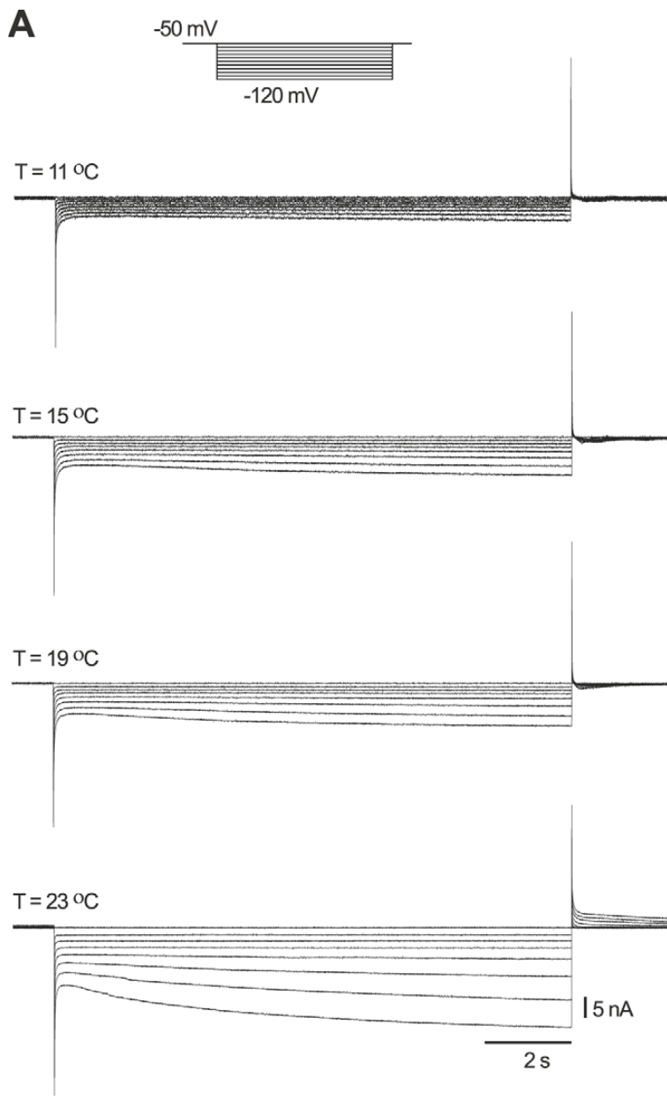
Hyperpolarization recruits an opposing inward current
The hyperpolarization-activated inward current, I_h, turns on as the membrane becomes more negative. It carries a depolarizing influence during and after inhibition, opposing the voltage effect of sustained inhibitory input. Its activation can therefore interact with the outward I_A current in determining LP rebound.
Tang and colleagues applied hyperpolarizing voltage steps from a holding potential near −50 mV, with test potentials extending to −120 mV. The slowly developing inward current was recorded at several temperatures. The published recordings have a 15 nA current calibration and a 2 s time calibration.
Warming increased I_h conductance and accelerated its activation. Its temperature sensitivity differed from that of I_A and synaptic inhibition. The observed phase stability must therefore arise from combined processes; it cannot be attributed to every current changing by the same amount or remaining unchanged.
Tang et al. (2010), Fig. 2(B). Crab pyloric circuit
Tang et al. (2010), Fig. 5(A). Hyperpolarization-activated current recordings across temperature
Tang et al. (2010)
39
Notes:
• The hyperpolarization-activated inward current, Ih, turns on as the membrane becomes more negative. It carries a depolarizing influence during and after inhibition, opposing the voltage effect of sustained inhibitory input. Its activation can therefore interact with the outward IA current in determining LP rebound.
– An inward current need not create an action potential immediately; it can alter how quickly a neuron approaches the voltage range where spikes begin.
• Tang and colleagues applied hyperpolarizing voltage steps from a holding potential near −50 mV, with test potentials extending to −120 mV. The slowly developing inward current was recorded at several temperatures. The published recordings have a 15 nA current calibration and a 2 s time calibration.
– The current grows during a sustained hyperpolarizing step, unlike the transient decline of I_A during a depolarizing step.
• Warming increased Ih conductance and accelerated its activation. Its temperature sensitivity differed from that of IA and synaptic inhibition. The observed phase stability must therefore arise from combined processes; it cannot be attributed to every current changing by the same amount or remaining unchanged.
– The experiment measures an electrical current and its temperature dependence, rather than directly counting the channel proteins in the membrane.
References:
Tang LS, Goeritz ML, Caplan JS, Taylor AL, Fisek M, Marder E. (2010). Precise temperature compensation of phase in a rhythmic motor pattern. PLoS Biology 8: e1000469. https://doi.org/10.1371/journal.pbio.1000469
Figure: Tang et al. (2010), Fig. 5(A). Hyperpolarization-activated current recordings across temperature
Figure source: https://doi.org/10.1371/journal.pbio.1000469
Figure: Tang et al. (2010), Fig. 2(B). Crab pyloric circuit
Figure source: https://doi.org/10.1371/journal.pbio.1000469

Slide 40
A weakly driven gastric rhythm fails after modest warming
Städele and colleagues held MCN1 stimulation constant near the minimum frequency that recruited a gastric mill rhythm at 10°C. They then warmed the crab STG to 13°C while recording LG. This isolated preparation lacked the anterior circuits that could naturally increase descending drive.
LG’s regular bursts disappeared at 13°C with the same MCN1 stimulation. Cooling back to 10°C restored them. The published example used a 6 Hz stimulus throughout, separating temperature-dependent circuit failure from an intentional reduction of input frequency.
The failure was conditional on the weak, fixed drive and the isolated preparation. It does not establish that a living crab loses chewing after every 3°C temperature increase. A different input strength or naturally changing descending activity can preserve the slow motor rhythm at the same temperature.
Städele et al. (2015), Fig. 1(A). Gastric circuit
Städele et al. (2015), Fig. 2(A). Fixed 6 Hz MCN1 drive fails at 13°C and recovers after cooling
Städele et al. (2015)
40
Notes:
• Städele and colleagues held MCN1 stimulation constant near the minimum frequency that recruited a gastric mill rhythm at 10°C. They then warmed the crab STG to 13°C while recording LG. This isolated preparation lacked the anterior circuits that could naturally increase descending drive.
– The within-preparation return to 10°C is a recovery control, reducing the likelihood that the lost bursting simply reflected irreversible damage.
• LG’s regular bursts disappeared at 13°C with the same MCN1 stimulation. Cooling back to 10°C restored them. The published example used a 6 Hz stimulus throughout, separating temperature-dependent circuit failure from an intentional reduction of input frequency.
– The term failure here refers to the absence of rhythmic LG bursting, even when some spikes or membrane activity remained.
• The failure was conditional on the weak, fixed drive and the isolated preparation. It does not establish that a living crab loses chewing after every 3°C temperature increase. A different input strength or naturally changing descending activity can preserve the slow motor rhythm at the same temperature.
– Input state must accompany any temperature threshold: the authors could raise the permissive temperature range by increasing MCN1 stimulation.
References:
Städele C, Heigele S, Stein W. (2015). Neuromodulation to the Rescue: Compensation of Temperature-Induced Breakdown of Rhythmic Motor Patterns via Extrinsic Neuromodulatory Input. PLoS Biology 13: e1002265. https://doi.org/10.1371/journal.pbio.1002265
Figure: Städele et al. (2015), Fig. 2(A). Fixed 6 Hz MCN1 drive fails at 13°C and recovers after cooling
Figure source: https://doi.org/10.1371/journal.pbio.1002265
Figure: Städele et al. (2015), Fig. 1(A). Gastric circuit
Figure source: https://doi.org/10.1371/journal.pbio.1002265

Slide 41
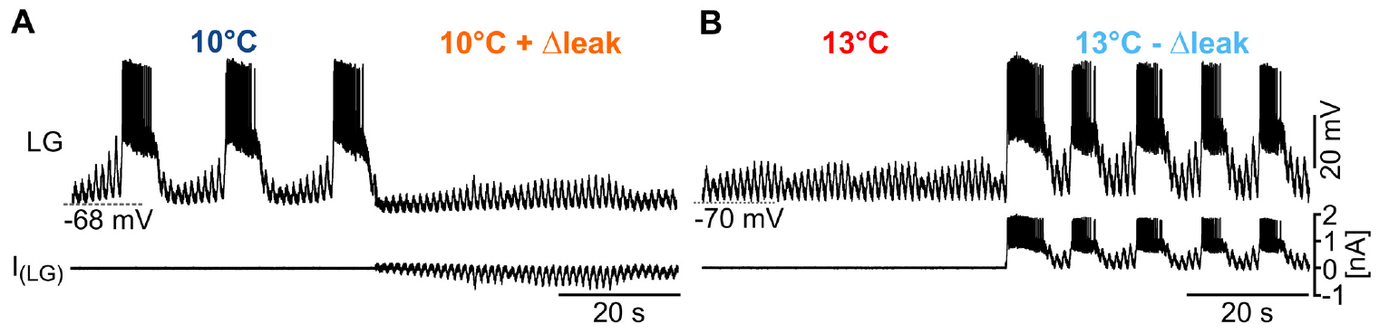
Leak conductance can stop or restore gastric bursting
A leak conductance is a membrane pathway that contributes current without the rapid voltage gating characteristic of spike-generating channels. Städele and colleagues found that warming reduced LG input resistance, so a given input current produced a smaller membrane-voltage change.
Dynamic clamp added an effective leak to LG at 10°C during 7 Hz MCN1 stimulation, and bursting stopped. At 13°C, subtracting an effective leak restored recurring LG bursts while the MCN1 stimulus remained unchanged. Opposite interventions tested whether the conductance change was sufficient to alter circuit output.
Leak subtraction is an imposed electrical compensation, rather than direct removal of a channel protein. The causal result connects LG membrane responsiveness to gastric rhythmicity in this preparation. It does not establish that the animal compensates warming by physically closing exactly the channels represented in the clamp.
Städele et al. (2015), Fig. 4(A–B). Added leak stops bursting; leak subtraction rescues it
Städele et al. (2015), Fig. 1(A). Gastric circuit
Städele et al. (2015)
41
Notes:
• A leak conductance is a membrane pathway that contributes current without the rapid voltage gating characteristic of spike-generating channels. Städele and colleagues found that warming reduced LG input resistance, so a given input current produced a smaller membrane-voltage change.
– Input resistance describes the voltage response to an injected current; a larger effective membrane conductance makes that response smaller.
• Dynamic clamp added an effective leak to LG at 10°C during 7 Hz MCN1 stimulation, and bursting stopped. At 13°C, subtracting an effective leak restored recurring LG bursts while the MCN1 stimulus remained unchanged. Opposite interventions tested whether the conductance change was sufficient to alter circuit output.
– The dynamic clamp used the measured voltage to calculate an added or subtracted current continuously, while the biological circuit remained active.
• Leak subtraction is an imposed electrical compensation, rather than direct removal of a channel protein. The causal result connects LG membrane responsiveness to gastric rhythmicity in this preparation. It does not establish that the animal compensates warming by physically closing exactly the channels represented in the clamp.
– The addition and subtraction tests are stronger evidence than observing a resistance change and a rhythm change at the same time.
References:
Städele C, Heigele S, Stein W. (2015). Neuromodulation to the Rescue: Compensation of Temperature-Induced Breakdown of Rhythmic Motor Patterns via Extrinsic Neuromodulatory Input. PLoS Biology 13: e1002265. https://doi.org/10.1371/journal.pbio.1002265
Figure: Städele et al. (2015), Fig. 4(A–B). Added leak stops bursting; leak subtraction rescues it
Figure source: https://doi.org/10.1371/journal.pbio.1002265
Figure: Städele et al. (2015), Fig. 1(A). Gastric circuit
Figure source: https://doi.org/10.1371/journal.pbio.1002265

Slide 42
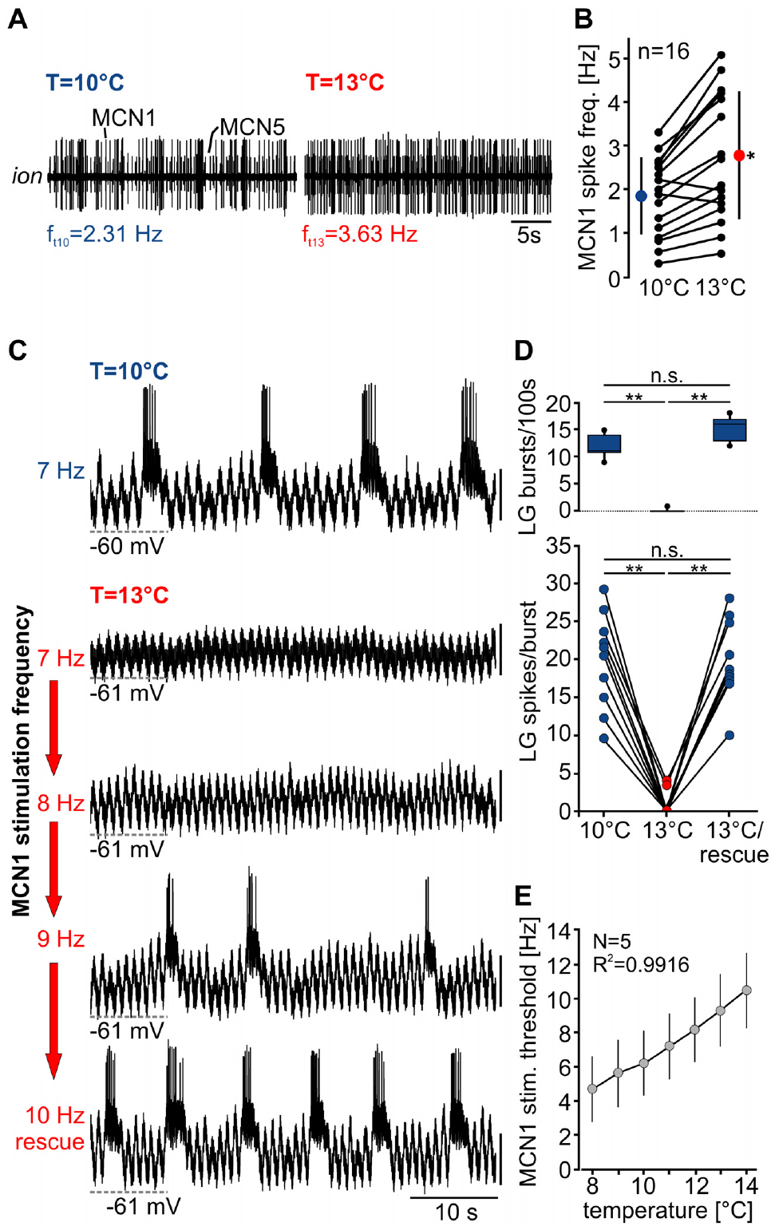
Stronger descending drive restores gastric output
The crab gastric mill rhythm persisted at 13°C in intact-animal recordings, despite failure of the isolated weakly driven preparation. Städele and colleagues tested whether descending MCN1 activity could supply compensatory input. They recorded MCN1 axonal activity from the commissural ganglion pathway during warming.
MCN1 firing increased with temperature. In the published example it rose from 2.31 Hz at 10°C to 3.63 Hz at 13°C. In a separate controlled stimulation test, increasing imposed MCN1 activity from 7 Hz to 9 Hz at 13°C restored LG bursting; returning to 7 Hz removed that rescue.
Descending drive can compensate a temperature-sensitive local circuit. The intact-animal comparison supports a role for naturally changing input but does not isolate MCN1 as the only compensatory pathway in vivo. Circuit robustness depends on the nervous-system components retained by the experimental preparation.
Städele et al. (2015), Fig. 1(A). Gastric circuit
Städele et al. (2015), Fig. 6(A–E). MCN1 activity increases with warming and stronger stimulation rescues LG
Städele et al. (2015)
42
Notes:
• The crab gastric mill rhythm persisted at 13°C in intact-animal recordings, despite failure of the isolated weakly driven preparation. Städele and colleagues tested whether descending MCN1 activity could supply compensatory input. They recorded MCN1 axonal activity from the commissural ganglion pathway during warming.
– The MCN1 recordings were made from the remaining nerve connected to its cell-body ganglion, so the measured firing was not inferred from LG output.
• MCN1 firing increased with temperature. In the published example it rose from 2.31 Hz at 10°C to 3.63 Hz at 13°C. In a separate controlled stimulation test, increasing imposed MCN1 activity from 7 Hz to 9 Hz at 13°C restored LG bursting; returning to 7 Hz removed that rescue.
– The controlled rescue changed stimulation frequency while holding the elevated STG temperature fixed.
• Descending drive can compensate a temperature-sensitive local circuit. The intact-animal comparison supports a role for naturally changing input but does not isolate MCN1 as the only compensatory pathway in vivo. Circuit robustness depends on the nervous-system components retained by the experimental preparation.
– The intact recordings and isolated stimulation experiments answer complementary questions: whether the rhythm survives in the animal, and whether stronger MCN1 drive can restore it in a defined circuit state.
References:
Städele C, Heigele S, Stein W. (2015). Neuromodulation to the Rescue: Compensation of Temperature-Induced Breakdown of Rhythmic Motor Patterns via Extrinsic Neuromodulatory Input. PLoS Biology 13: e1002265. https://doi.org/10.1371/journal.pbio.1002265
Figure: Städele et al. (2015), Fig. 6(A–E). MCN1 activity increases with warming and stronger stimulation rescues LG
Figure source: https://doi.org/10.1371/journal.pbio.1002265
Figure: Städele et al. (2015), Fig. 1(A). Gastric circuit
Figure source: https://doi.org/10.1371/journal.pbio.1002265

Slide 43
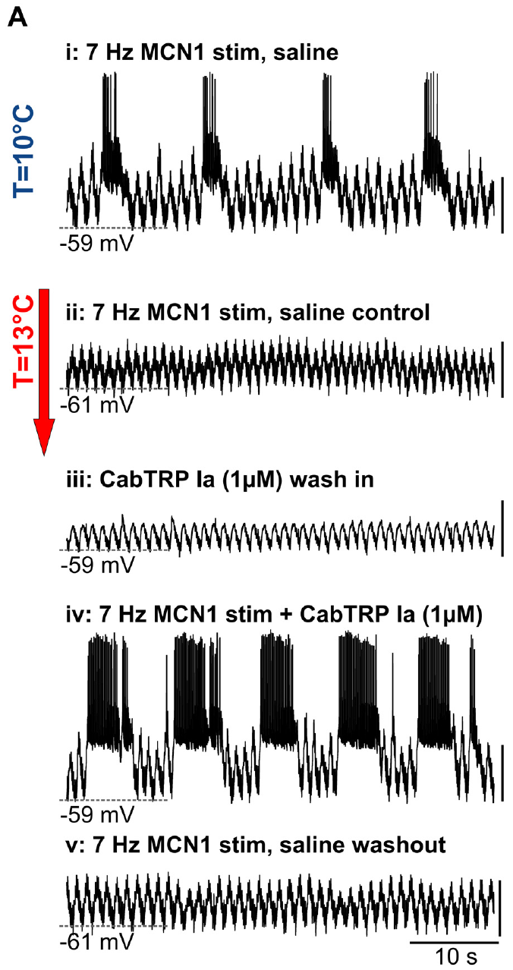
CabTRP Ia can rescue the rhythm with continuing input
Städele and colleagues applied 1 μM CabTRP Ia to the warmed crab STG. CabTRP Ia is a peptide cotransmitter of MCN1: cotransmission means that one neuron supplies more than one chemical signal. The peptide can strengthen the modulatory influence received by LG without increasing the imposed axonal stimulus frequency.
At 13°C, 7 Hz MCN1 stimulation alone failed to sustain LG bursts in the published example. CabTRP Ia together with continuing stimulation restored rhythmic bursting. Peptide application without the accompanying stimulation did not fully recreate that recovered rhythm, and washout removed the rescue.
The peptide and remaining MCN1 actions jointly maintained the effective drive needed for oscillation. Activation of I_MI can counteract the temperature-associated loss of membrane responsiveness; the authors’ conductance model supports that explanation. The rescue recording itself does not identify every intervening signaling molecule or exclude additional MCN1 mechanisms.
Städele et al. (2015), Fig. 1(A). Gastric circuit
Städele et al. (2015), Fig. 7(A). CabTRP Ia with continuing MCN1 drive restores LG bursts at 13°C
Städele et al. (2015)
43
Notes:
• Städele and colleagues applied 1 μM CabTRP Ia to the warmed crab STG. CabTRP Ia is a peptide cotransmitter of MCN1: cotransmission means that one neuron supplies more than one chemical signal. The peptide can strengthen the modulatory influence received by LG without increasing the imposed axonal stimulus frequency.
– The same neuron can release signals whose actions differ in time course and target, so bath application of one cotransmitter need not reproduce complete neuron stimulation.
• At 13°C, 7 Hz MCN1 stimulation alone failed to sustain LG bursts in the published example. CabTRP Ia together with continuing stimulation restored rhythmic bursting. Peptide application without the accompanying stimulation did not fully recreate that recovered rhythm, and washout removed the rescue.
– The experiment included peptide alone, peptide with continued MCN1 stimulation and peptide washout while the elevated temperature was maintained.
• The peptide and remaining MCN1 actions jointly maintained the effective drive needed for oscillation. Activation of IMI can counteract the temperature-associated loss of membrane responsiveness; the authors’ conductance model supports that explanation. The rescue recording itself does not identify every intervening signaling molecule or exclude additional MCN1 mechanisms.
– The mechanistic proposal is that additional inward current offsets the increased effective leak; molecular steps linking the peptide receptor to the channel were not resolved by this rescue experiment.
References:
Städele C, Heigele S, Stein W. (2015). Neuromodulation to the Rescue: Compensation of Temperature-Induced Breakdown of Rhythmic Motor Patterns via Extrinsic Neuromodulatory Input. PLoS Biology 13: e1002265. https://doi.org/10.1371/journal.pbio.1002265
Figure: Städele et al. (2015), Fig. 7(A). CabTRP Ia with continuing MCN1 drive restores LG bursts at 13°C
Figure source: https://doi.org/10.1371/journal.pbio.1002265
Figure: Städele et al. (2015), Fig. 1(A). Gastric circuit
Figure source: https://doi.org/10.1371/journal.pbio.1002265

Slide 44
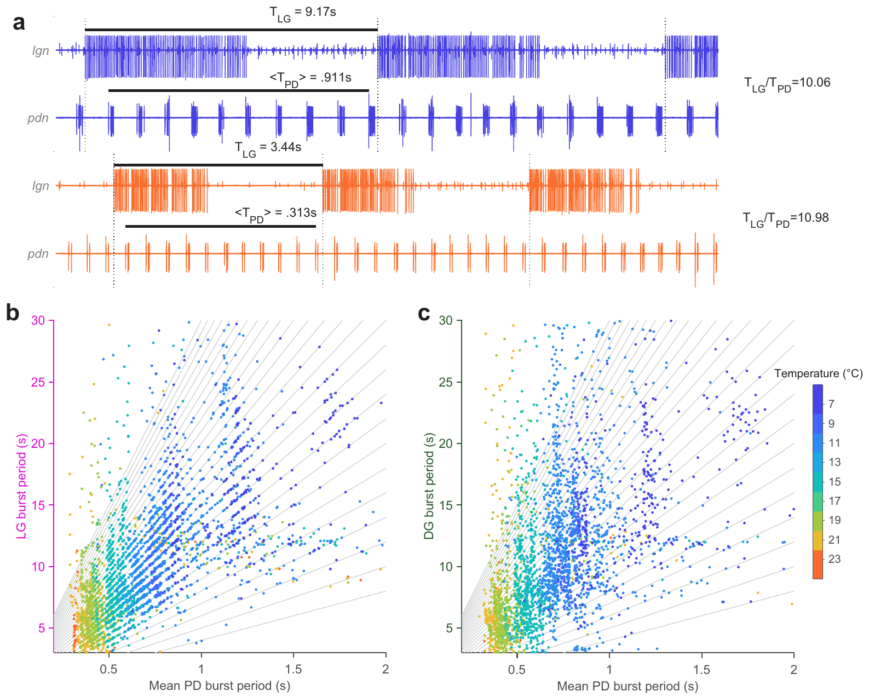
Fast and slow rhythms retain integer coupling
Integer coupling means that a slow rhythm’s cycle duration lies close to a whole-number multiple of a faster rhythm’s period. Powell and colleagues tested this relationship between crab gastric LG bursts and pyloric PD bursts while changing temperature from 7°C to 23°C.
Both rhythms accelerated, yet LG cycles remained close to integer numbers of PD cycles. In the published example, an LG cycle lasted 9.17 s with a mean PD period of 0.911 s at 7°C; at 23°C, the corresponding values were 3.44 s and 0.313 s. The integer number itself could change.
Coordination therefore persisted without holding either oscillator’s frequency constant. LG burst starts retained a preferred pyloric phase, whereas DG coupling was weaker. These are empirical timing relationships; they do not establish that every gastric rhythm produced by every descending input follows the same coupling rule.
Powell et al. (2021), Fig. 1(c). Crab STG circuit
Powell et al. (2021), Fig. 5(a–c). Gastric periods remain near integer multiples of pyloric periods
Powell et al. (2021)
44
Notes:
• Integer coupling means that a slow rhythm’s cycle duration lies close to a whole-number multiple of a faster rhythm’s period. Powell and colleagues tested this relationship between crab gastric LG bursts and pyloric PD bursts while changing temperature from 7°C to 23°C.
– The cycle ratios in the published example are approximately ten and eleven, so integer coupling does not mean an invariant ten-to-one ratio.
• Both rhythms accelerated, yet LG cycles remained close to integer numbers of PD cycles. In the published example, an LG cycle lasted 9.17 s with a mean PD period of 0.911 s at 7°C; at 23°C, the corresponding values were 3.44 s and 0.313 s. The integer number itself could change.
– AB inhibition of Int1 can create a brief reduction in inhibition of LG, contributing a pyloric-timed opportunity for LG burst initiation.
• Coordination therefore persisted without holding either oscillator’s frequency constant. LG burst starts retained a preferred pyloric phase, whereas DG coupling was weaker. These are empirical timing relationships; they do not establish that every gastric rhythm produced by every descending input follows the same coupling rule.
– The strong contrast with the weakly driven 2015 preparation is consistent with different circuit and input states, rather than a universal temperature threshold for gastric rhythms.
References:
Powell D, Haddad SA, Gorur-Shandilya S, Marder E. (2021). Coupling between fast and slow oscillator circuits in Cancer borealis is temperature-compensated. eLife 10: e60454. https://doi.org/10.7554/elife.60454
Figure: Powell et al. (2021), Fig. 5(a–c). Gastric periods remain near integer multiples of pyloric periods
Figure source: https://doi.org/10.7554/elife.60454
Figure: Powell et al. (2021), Fig. 1(c). Crab STG circuit
Figure source: https://doi.org/10.7554/elife.60454

Slide 45
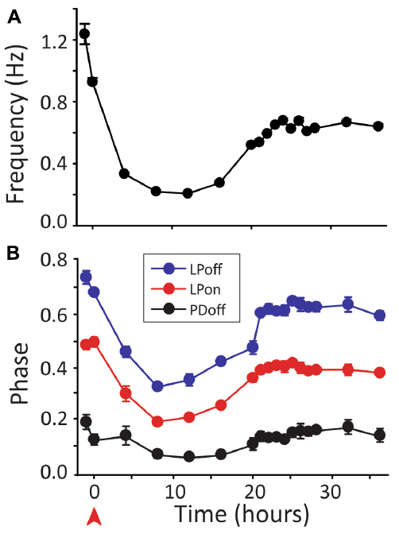

Circuit activity can recover after input removal
More-Potdar and Golowasch followed crab pyloric preparations for many hours after decentralization, removal of descending modulatory input. They recorded the outgoing motor rhythm over time and tested its phase relationships at different temperatures. Immediate slowing was therefore distinguished from the later state of the same circuit.
In the published time course, the study reported frequency recovery to approximately 75% of control and phases to within about 10% of control after approximately 24 h. Temperature tests found recovery of several phase relationships across the tested range, with incomplete recovery for some measures over the broadest range.
Long-term recovery supports regulation of functional output after loss of modulation. The authors propose homeostatic changes in intrinsic and synaptic properties; the experiment does not identify one uniquely responsible channel change. Near-normal baseline rhythmicity and resilience to temperature are distinct properties that require separate measurements.
More-Potdar & Golowasch (2023), Fig. 1(B). Pyloric circuit
More-Potdar & Golowasch (2023), Fig. 2(A–B). Frequency and phase recover over hours after decentralization
More-Potdar & Golowasch (2023)
45
Notes:
• More-Potdar and Golowasch followed crab pyloric preparations for many hours after decentralization, removal of descending modulatory input. They recorded the outgoing motor rhythm over time and tested its phase relationships at different temperatures. Immediate slowing was therefore distinguished from the later state of the same circuit.
– Homeostatic regulation is compensatory adjustment that tends to restore a functional property after perturbation; recovery of output does not imply restoration of the original parameter values.
• In the published time course, the study reported frequency recovery to approximately 75% of control and phases to within about 10% of control after approximately 24 h. Temperature tests found recovery of several phase relationships across the tested range, with incomplete recovery for some measures over the broadest range.
– The study compared time-matched connected and decentralized preparations, reducing confusion between recovery and the ordinary passage of time in an isolated preparation.
• Long-term recovery supports regulation of functional output after loss of modulation. The authors propose homeostatic changes in intrinsic and synaptic properties; the experiment does not identify one uniquely responsible channel change. Near-normal baseline rhythmicity and resilience to temperature are distinct properties that require separate measurements.
– Recovery of motor-nerve output does not establish normal feeding behavior in a crab after removal of its descending inputs.
References:
More-Potdar S, Golowasch J. (2023). Oscillatory network spontaneously recovers both activity and robustness after prolonged removal of neuromodulators. Frontiers in Cellular Neuroscience 17: 1280575. https://doi.org/10.3389/fncel.2023.1280575
Figure: More-Potdar & Golowasch (2023), Fig. 2(A–B). Frequency and phase recover over hours after decentralization
Figure source: https://doi.org/10.3389/fncel.2023.1280575
Figure: More-Potdar & Golowasch (2023), Fig. 1(B). Pyloric circuit
Figure source: https://doi.org/10.3389/fncel.2023.1280575

Slide 46
Key takeaways
Pacemaker and conditional bursters. Isolated AB retains spontaneous bursting; PD and several followers can express oscillations when appropriate input recruits them.
Electrical and chemical pathways. AB and PD synchronize electrically but have different chemical outputs. An IPSP in a coupled cell can arrive indirectly through its partner.
Transmitter and target determine action. ACh excites the lobster PD-innervated dilator muscle. Central inhibition depends on the postsynaptic ionic mechanism, not on transmitter identity alone.
Phase depends on active synaptic timing. Inhibition, its duration and peak timing, and the neuron’s membrane currents jointly determine follower burst onset. Graded release can function without spikes.
Modulation changes the operative mechanism. Modulators differ in target neurons and synaptic actions. Activating the same inward current does not guarantee the same spike dependence or network output.
Robustness depends on state and timescale. Pyloric phase and gastric–pyloric coupling can survive warming. Descending drive can rescue weak gastric rhythms, and prolonged input loss can be followed by recovery.
Marder (1976); Miller & Selverston (1982); Eisen & Marder (1982); Tang et al. (2010); Städele et al. (2015); Rosenbaum & Marder (2018); Powell et al. (2021)
46
Notes:
References:
Powell D, Haddad SA, Gorur-Shandilya S, Marder E. (2021). Coupling between fast and slow oscillator circuits in Cancer borealis is temperature-compensated. eLife 10: e60454. https://doi.org/10.7554/elife.60454
Garcia VJ, Daur N, Temporal S, Schulz DJ, Bucher D. (2015). Neuropeptide receptor transcript expression levels and magnitude of ionic current responses show cell type-specific differences in a small motor circuit. Journal of Neuroscience 35: 6786-6800. https://doi.org/10.1523/jneurosci.0171-15.2015
Miller JP, Selverston AI. (1982). Mechanisms underlying pattern generation in lobster stomatogastric ganglion as determined by selective inactivation of identified neurons. II. Oscillatory properties of pyloric neurons. Journal of Neurophysiology 48: 1378-1391. https://doi.org/10.1152/jn.1982.48.6.1378
Hooper SL, Marder E. (1987). Modulation of the lobster pyloric rhythm by the peptide proctolin. Journal of Neuroscience 7: 2097-2112. https://doi.org/10.1523/jneurosci.07-07-02097.1987
Rosenbaum P, Marder E. (2018). Graded Transmission without Action Potentials Sustains Rhythmic Activity in Some But Not All Modulators That Activate the Same Current. Journal of Neuroscience 38: 8976-8988. https://doi.org/10.1523/jneurosci.2632-17.2018
Gorur-Shandilya S, Cronin EM, Schneider AC, Haddad SA, Rosenbaum P, Bucher D, Nadim F, Marder E. (2022). Mapping circuit dynamics during function and dysfunction. eLife 11: e76579. https://doi.org/10.7554/elife.76579
Eisen JS, Marder E. (1982). Mechanisms underlying pattern generation in lobster stomatogastric ganglion as determined by selective inactivation of identified neurons. III. Synaptic connections of electrically coupled pyloric neurons. Journal of Neurophysiology 48: 1392-1415. https://doi.org/10.1152/jn.1982.48.6.1392
Marder E. (1976). Cholinergic motor neurones in the stomatogastric system of the lobster. The Journal of Physiology 257: 63-86. https://doi.org/10.1113/jphysiol.1976.sp011356
Martinez D, Anwar H, Bose A, Bucher DM, Nadim F. (2019). Short-term synaptic dynamics control the activity phase of neurons in an oscillatory network. eLife 8: e46911. https://doi.org/10.7554/elife.46911
Tang LS, Goeritz ML, Caplan JS, Taylor AL, Fisek M, Marder E. (2010). Precise temperature compensation of phase in a rhythmic motor pattern. PLoS Biology 8: e1000469. https://doi.org/10.1371/journal.pbio.1000469
Schneider AC, Itani O, Bucher D, Nadim F. (2022). Neuromodulation Reduces Interindividual Variability of Neuronal Output. eNeuro 9: ENEURO.0166-22.2022. https://doi.org/10.1523/eneuro.0166-22.2022
Städele C, Heigele S, Stein W. (2015). Neuromodulation to the Rescue: Compensation of Temperature-Induced Breakdown of Rhythmic Motor Patterns via Extrinsic Neuromodulatory Input. PLoS Biology 13: e1002265. https://doi.org/10.1371/journal.pbio.1002265
More-Potdar S, Golowasch J. (2023). Oscillatory network spontaneously recovers both activity and robustness after prolonged removal of neuromodulators. Frontiers in Cellular Neuroscience 17: 1280575. https://doi.org/10.3389/fncel.2023.1280575

