Slide 1
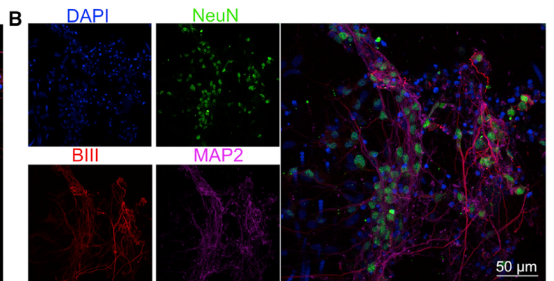
NEUR 411 · NEUROETHOLOGY · FALL 2026
Lecture 72
Biocomputing II:
From Pong to Doom — sensory encoding, feedback, adaptive behavior, and neuroethical questions of sentience and welfare
Date TBD
Jordan Lopez, Ph.D.
Professor of Neurobiology & Biomedical Engineering
Kagan et al. (2022), Fig. 2B. Human cortical neurons used in DishBrain.
Notes:
Biocomputing II: From Pong to Doom — sensory encoding, feedback, adaptive behavior, and neuroethical questions of sentience and welfare
Lecture 72. NEUR 411 · NEUROETHOLOGY · FALL 2026. Date TBD.
Figure: Kagan et al. (2022), Fig. 2B. Human cortical neurons used in DishBrain.
Figure source: https://doi.org/10.1016/j.neuron.2022.09.001
References:
Kagan BJ; Kitchen AC; Tran NT; Habibollahi F; Khajehnejad M; Parker BJ; Bhat A; Rollo B; Razi A; Friston KJ (2022). In vitro neurons learn and exhibit sentience when embodied in a simulated game-world. Neuron 110(23):3952–3969.e8. https://doi.org/10.1016/j.neuron.2022.09.001

Slide 2
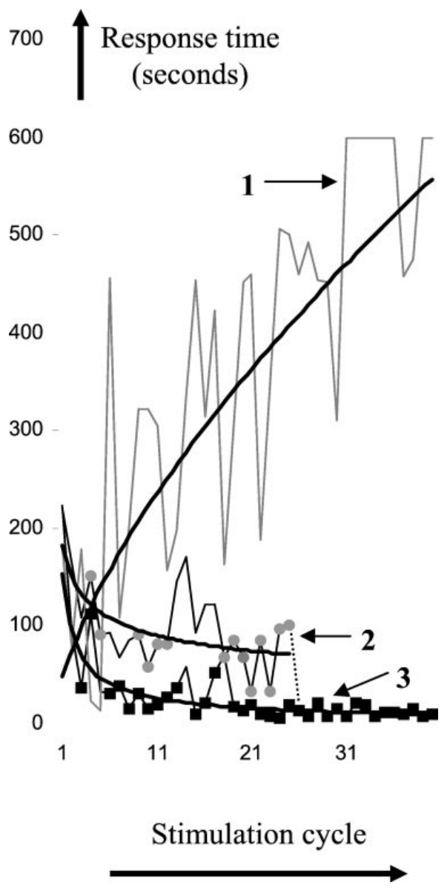
Contingent stimulation trains a neural response
Operant conditioning changes the occurrence of a response by making its consequences depend on whether that response occurs. Shahaf and Marom applied this principle to dissociated rat cortical neurons, replacing an animal's movement with an electrically recorded response in a culture.
A computer stimulated the network and monitored a selected recording electrode. When activity satisfied a predefined response criterion, stimulation stopped for 5 min. The network therefore controlled the timing of an external event through its own electrical activity.
Across repeated cycles, trained cultures reached the criterion more quickly. A control protocol delivered stimulation for a fixed duration regardless of activity. The difference between these conditions connects learning to the relationship between a response and its consequence, rather than to repeated stimulation alone.
Shahaf & Marom (2001), Fig. 6. Response acquisition with and without contingent stimulus removal.
Shahaf & Marom (2001)
02
Notes:
• Operant conditioning changes the occurrence of a response by making its consequences depend on whether that response occurs. Shahaf and Marom applied this principle to dissociated rat cortical neurons, replacing an animal's movement with an electrically recorded response in a culture.
• A computer stimulated the network and monitored a selected recording electrode. When activity satisfied a predefined response criterion, stimulation stopped for 5 min. The network therefore controlled the timing of an external event through its own electrical activity.
• Across repeated cycles, trained cultures reached the criterion more quickly. A control protocol delivered stimulation for a fixed duration regardless of activity. The difference between these conditions connects learning to the relationship between a response and its consequence, rather than to repeated stimulation alone.
References:
Shahaf G; Marom S (2001). Learning in networks of cortical neurons. Journal of Neuroscience 21(22):8782–8788. https://doi.org/10.1523/JNEUROSCI.21-22-08782.2001
Figure: Shahaf & Marom (2001), Fig. 6. Response acquisition with and without contingent stimulus removal.
Figure source: https://doi.org/10.1523/JNEUROSCI.21-22-08782.2001

Slide 3
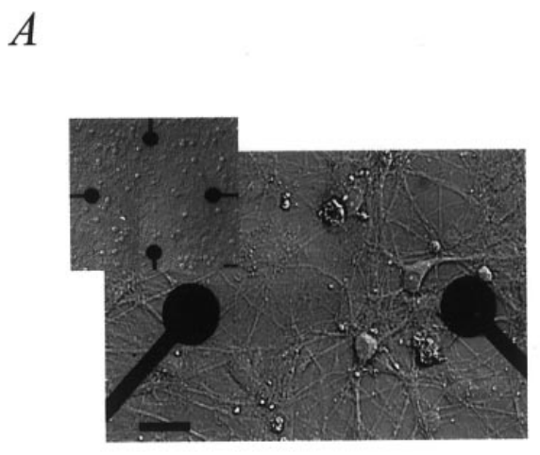
Interconnected neurons support conditioning
Shahaf and Marom dissociated cortex from newborn rats and plated the cells on a multielectrode array, a substrate containing multiple conducting sites for extracellular recording and stimulation. Neurites, the processes extending from neuronal cell bodies, grew across the electrode-bearing surface.
The neurons formed a network before conditioning began in the third week after plating. Activity recorded at different sites occurred in reproducible temporal relationships. These relationships supplied a repertoire of responses from which the computer could select a conditioning target.
The electrodes sampled nearby electrical events rather than measuring the entire network. A selected electrode was consequently a response channel within an interconnected preparation. Conditioning changed the occurrence of activity at that channel while stimulation continued to recruit the surrounding cortical network.
Shahaf & Marom (2001), Fig. 1A. Cortical neurons growing across recording electrodes.
Shahaf & Marom (2001)
03
Notes:
• Shahaf and Marom dissociated cortex from newborn rats and plated the cells on a multielectrode array, a substrate containing multiple conducting sites for extracellular recording and stimulation. Neurites, the processes extending from neuronal cell bodies, grew across the electrode-bearing surface.
• The neurons formed a network before conditioning began in the third week after plating. Activity recorded at different sites occurred in reproducible temporal relationships. These relationships supplied a repertoire of responses from which the computer could select a conditioning target.
• The electrodes sampled nearby electrical events rather than measuring the entire network. A selected electrode was consequently a response channel within an interconnected preparation. Conditioning changed the occurrence of activity at that channel while stimulation continued to recruit the surrounding cortical network.
References:
Shahaf G; Marom S (2001). Learning in networks of cortical neurons. Journal of Neuroscience 21(22):8782–8788. https://doi.org/10.1523/JNEUROSCI.21-22-08782.2001
Figure: Shahaf & Marom (2001), Fig. 1A. Cortical neurons growing across recording electrodes.
Figure source: https://doi.org/10.1523/JNEUROSCI.21-22-08782.2001

Slide 4
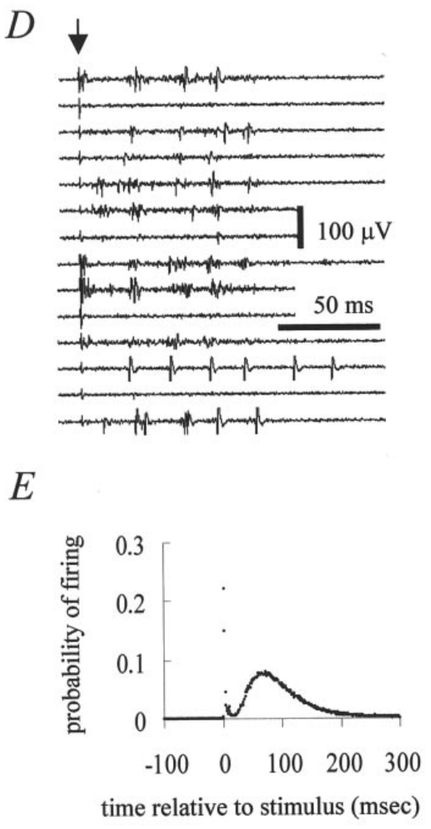
A pulse evokes immediate and delayed activity
Extracellular stimulation applies an electrical pulse outside the cells, recruiting excitable neural elements near an electrode. Shahaf and Marom used pulses lasting 420 µs at an amplitude of 50 µA. Recordings from multiple sites captured the activity that followed each pulse.
The response distribution contained an early peak associated with direct activation and a later component associated with activity reverberating through the network. Reverberation means that neural interactions sustain activity beyond the initial electrical input, producing delayed responses at recording sites.
The conditioning target belonged to this delayed response period. Selecting activity after the initial recruitment made the learned outcome depend on the network's evoked response pattern. Repeated stimulation could alter that pattern, while contingent stimulus removal selected responses occurring within the prescribed temporal window.
Shahaf & Marom (2001), Fig. 1D–E. Evoked traces and the post-stimulus response distribution.
Shahaf & Marom (2001)
04
Notes:
• Extracellular stimulation applies an electrical pulse outside the cells, recruiting excitable neural elements near an electrode. Shahaf and Marom used pulses lasting 420 µs at an amplitude of 50 µA. Recordings from multiple sites captured the activity that followed each pulse.
• The response distribution contained an early peak associated with direct activation and a later component associated with activity reverberating through the network. Reverberation means that neural interactions sustain activity beyond the initial electrical input, producing delayed responses at recording sites.
• The conditioning target belonged to this delayed response period. Selecting activity after the initial recruitment made the learned outcome depend on the network's evoked response pattern. Repeated stimulation could alter that pattern, while contingent stimulus removal selected responses occurring within the prescribed temporal window.
References:
Shahaf G; Marom S (2001). Learning in networks of cortical neurons. Journal of Neuroscience 21(22):8782–8788. https://doi.org/10.1523/JNEUROSCI.21-22-08782.2001
Figure: Shahaf & Marom (2001), Fig. 1D–E. Evoked traces and the post-stimulus response distribution.
Figure source: https://doi.org/10.1523/JNEUROSCI.21-22-08782.2001

Slide 5
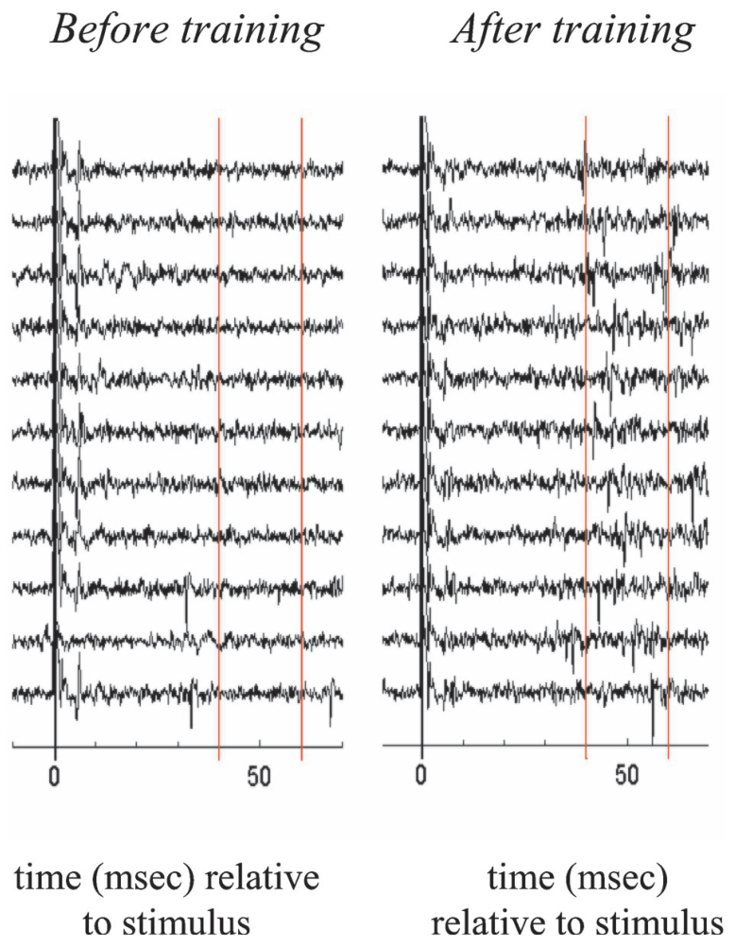
The target is activity within a defined time window
The conditioning task required a selected electrode to produce activity 40–60 ms after stimulation. Before training, the investigators chose an electrode whose responses rarely occurred in this interval. The target was therefore a particular delayed response, rather than an increase in all activity.
The computer monitored successive stimulation trials and stopped stimulation when at least two of the latest ten trials contained the target response. This moving criterion linked a short sequence of neural events to the cessation of external input.
After conditioning, activity occurred more often inside the target window. The relevant response specificity was temporal and spatial: the selected recording channel responded at the designated delay. Activity elsewhere or at another delay contributed to the network's dynamics but did not directly satisfy the programmed criterion.
Shahaf & Marom (2001), Fig. 2. Responses before and after conditioning.
Shahaf & Marom (2001)
05
Notes:
• The conditioning task required a selected electrode to produce activity 40–60 ms after stimulation. Before training, the investigators chose an electrode whose responses rarely occurred in this interval. The target was therefore a particular delayed response, rather than an increase in all activity.
• The computer monitored successive stimulation trials and stopped stimulation when at least two of the latest ten trials contained the target response. This moving criterion linked a short sequence of neural events to the cessation of external input.
• After conditioning, activity occurred more often inside the target window. The relevant response specificity was temporal and spatial: the selected recording channel responded at the designated delay. Activity elsewhere or at another delay contributed to the network's dynamics but did not directly satisfy the programmed criterion.
References:
Shahaf G; Marom S (2001). Learning in networks of cortical neurons. Journal of Neuroscience 21(22):8782–8788. https://doi.org/10.1523/JNEUROSCI.21-22-08782.2001
Figure: Shahaf & Marom (2001), Fig. 2. Responses before and after conditioning.
Figure source: https://doi.org/10.1523/JNEUROSCI.21-22-08782.2001

Slide 6
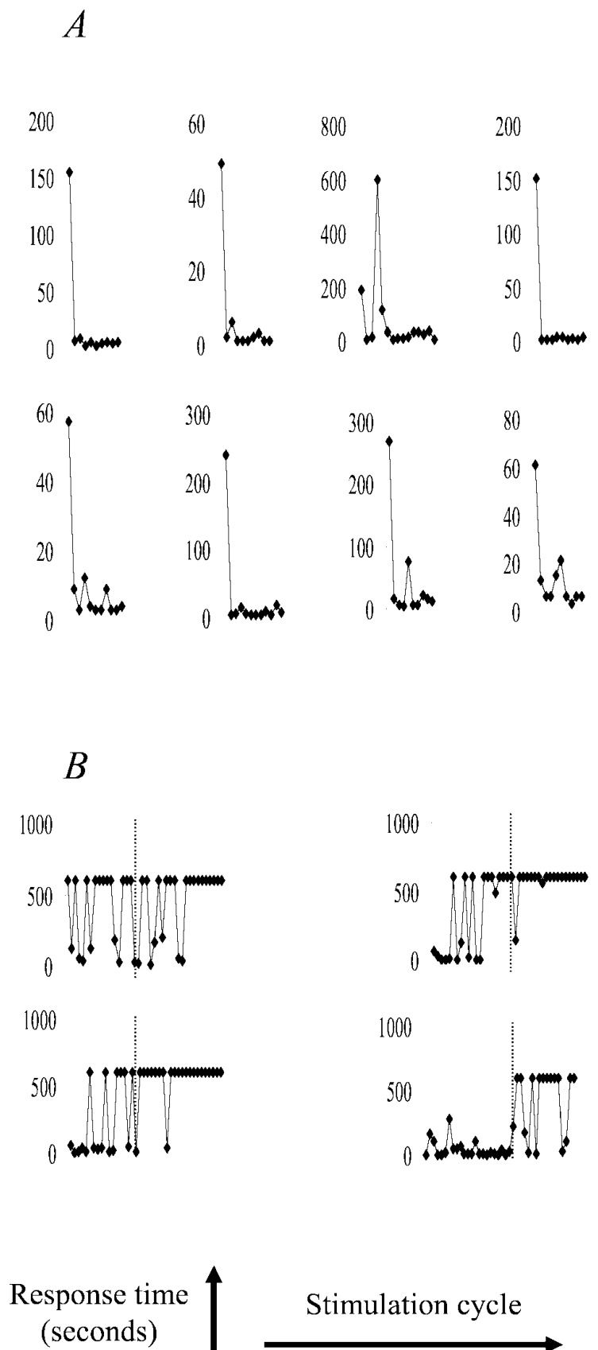
Training shortens acquisition time
Acquisition time is the duration of stimulation needed to satisfy the response criterion in one conditioning cycle. Shahaf and Marom stimulated at 0.3, 0.5, or 1 Hz, using the same frequency for successive cycles within a training protocol.
If the criterion occurred, stimulation stopped and a 5-min pause followed. If the criterion remained unmet for 10 min, stimulation also stopped. This maximum duration prevented an unsuccessful cycle from continuing indefinitely while preserving repeated opportunities for conditioning.
Acquisition times declined and stabilized during successful training. Fixed-duration control cycles, consisting of 10 min of stimulation followed by 5 min without stimulation, lacked the same systematic improvement. The declining acquisition time reflects an increasingly reliable route from stimulation to the selected network response.
Shahaf & Marom (2001), Fig. 3A–B. Learning curves and response-independent controls.
Shahaf & Marom (2001)
06
Notes:
• Acquisition time is the duration of stimulation needed to satisfy the response criterion in one conditioning cycle. Shahaf and Marom stimulated at 0.3, 0.5, or 1 Hz, using the same frequency for successive cycles within a training protocol.
• If the criterion occurred, stimulation stopped and a 5-min pause followed. If the criterion remained unmet for 10 min, stimulation also stopped. This maximum duration prevented an unsuccessful cycle from continuing indefinitely while preserving repeated opportunities for conditioning.
• Acquisition times declined and stabilized during successful training. Fixed-duration control cycles, consisting of 10 min of stimulation followed by 5 min without stimulation, lacked the same systematic improvement. The declining acquisition time reflects an increasingly reliable route from stimulation to the selected network response.
References:
Shahaf G; Marom S (2001). Learning in networks of cortical neurons. Journal of Neuroscience 21(22):8782–8788. https://doi.org/10.1523/JNEUROSCI.21-22-08782.2001
Figure: Shahaf & Marom (2001), Fig. 3A–B. Learning curves and response-independent controls.
Figure source: https://doi.org/10.1523/JNEUROSCI.21-22-08782.2001

Slide 7
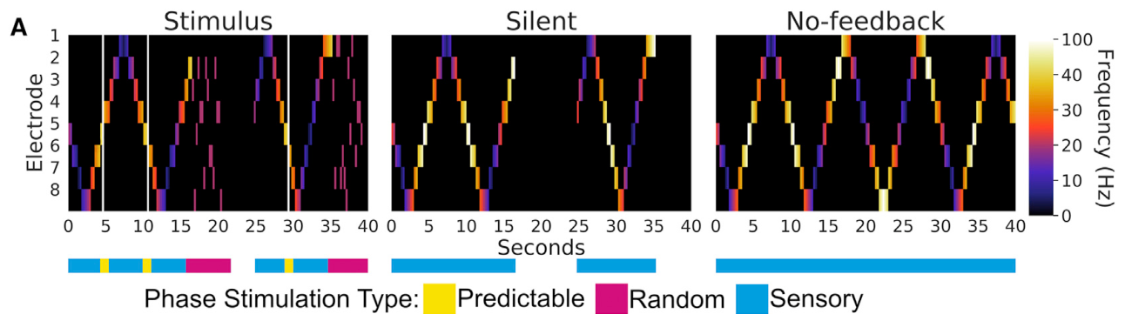
A feedback loop makes action change subsequent input
Closed-loop control links a system's output to the input it subsequently receives. In DishBrain, Kagan and colleagues used neural activity to move a virtual Pong paddle. Paddle movement affected interception of a moving ball, and interception changed the stimulation delivered to the culture.
The loop therefore included the neuronal network, electrode interface, software decoder, simulated environment, and stimulation encoder. Each component contributed to the causal relationship between recorded activity and its consequences. The cells received electrical pulses rather than a visual image of the screen.
The resulting task was defined by this interface. Neural activity had behavioral meaning because the software mapped it onto paddle displacement, while the environment returned input contingent on the resulting action. The same culture could therefore occupy different functional states during spontaneous recording and interactive gameplay.
Kagan et al. (2022), Fig. 6A. Outcome-dependent stimulation during gameplay.
Kagan et al. (2022)
07
Notes:
• Closed-loop control links a system's output to the input it subsequently receives. In DishBrain, Kagan and colleagues used neural activity to move a virtual Pong paddle. Paddle movement affected interception of a moving ball, and interception changed the stimulation delivered to the culture.
• The loop therefore included the neuronal network, electrode interface, software decoder, simulated environment, and stimulation encoder. Each component contributed to the causal relationship between recorded activity and its consequences. The cells received electrical pulses rather than a visual image of the screen.
• The resulting task was defined by this interface. Neural activity had behavioral meaning because the software mapped it onto paddle displacement, while the environment returned input contingent on the resulting action. The same culture could therefore occupy different functional states during spontaneous recording and interactive gameplay.
References:
Kagan BJ; Kitchen AC; Tran NT; Habibollahi F; Khajehnejad M; Parker BJ; Bhat A; Rollo B; Razi A; Friston KJ (2022). In vitro neurons learn and exhibit sentience when embodied in a simulated game-world. Neuron 110(23):3952–3969.e8. https://doi.org/10.1016/j.neuron.2022.09.001
Figure: Kagan et al. (2022), Fig. 6A. Outcome-dependent stimulation during gameplay.
Figure source: https://doi.org/10.1016/j.neuron.2022.09.001

Slide 8
Human neurons supply the biological controller
DishBrain included human cortical neurons derived from induced pluripotent stem cells, cells reprogrammed into a state capable of generating multiple differentiated cell types. The experiment also used primary mouse cortical cultures. Both preparations generated the electrical activity required for interaction with the game.
Immunostaining identified neuronal cell bodies and processes in the human cultures. MAP2 labeling marked dendrites, neuronal processes receiving synaptic input, and other neuronal markers supported the characterization of the preparation. These networks supplied the biological controller coupled to the computer interface.
The game decoder read activity from assigned output regions rather than imposing an artificial neural-network learning rule on each biological neuron. Adaptation occurred within a living, interconnected preparation, while the electronic system specified which recorded activity moved the paddle and which external events produced stimulation.
Kagan et al. (2022), Fig. 2B. Immunostained human cortical neurons and their processes.
Kagan et al. (2022)
08
Notes:
• DishBrain included human cortical neurons derived from induced pluripotent stem cells, cells reprogrammed into a state capable of generating multiple differentiated cell types. The experiment also used primary mouse cortical cultures. Both preparations generated the electrical activity required for interaction with the game.
• Immunostaining identified neuronal cell bodies and processes in the human cultures. MAP2 labeling marked dendrites, neuronal processes receiving synaptic input, and other neuronal markers supported the characterization of the preparation. These networks supplied the biological controller coupled to the computer interface.
• The game decoder read activity from assigned output regions rather than imposing an artificial neural-network learning rule on each biological neuron. Adaptation occurred within a living, interconnected preparation, while the electronic system specified which recorded activity moved the paddle and which external events produced stimulation.
References:
Kagan BJ; Kitchen AC; Tran NT; Habibollahi F; Khajehnejad M; Parker BJ; Bhat A; Rollo B; Razi A; Friston KJ (2022). In vitro neurons learn and exhibit sentience when embodied in a simulated game-world. Neuron 110(23):3952–3969.e8. https://doi.org/10.1016/j.neuron.2022.09.001
Figure: Kagan et al. (2022), Fig. 2B. Immunostained human cortical neurons and their processes.
Figure source: https://doi.org/10.1016/j.neuron.2022.09.001

Slide 9
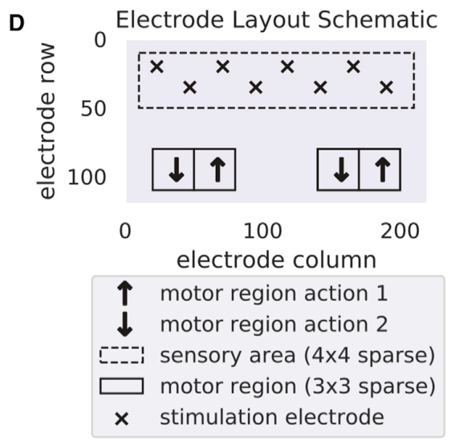
Place coding represents the ball's vertical position
A place code represents a variable through the location of activity or stimulation. DishBrain assigned eight electrodes to the sensory input region. Different stimulating sites corresponded to different positions of the virtual ball along the vertical axis of the game.
The code gave the culture a coarse spatial representation of ball position. The electrode layout was defined electronically, so the assigned sensory region was an input interface rather than a naturally developed sensory organ. Electrical stimulation recruited neurons near the selected sites.
A useful action required a relationship between this spatial input and output activity controlling vertical paddle movement. The culture's internal connections linked stimulation to distributed responses. Counterbalanced output assignments and control arrays helped assess whether the interface itself favored successful interception without biological adaptation.
Kagan et al. (2022), Fig. 4D. Sensory and motor electrode assignments.
Kagan et al. (2022)
09
Notes:
• A place code represents a variable through the location of activity or stimulation. DishBrain assigned eight electrodes to the sensory input region. Different stimulating sites corresponded to different positions of the virtual ball along the vertical axis of the game.
• The code gave the culture a coarse spatial representation of ball position. The electrode layout was defined electronically, so the assigned sensory region was an input interface rather than a naturally developed sensory organ. Electrical stimulation recruited neurons near the selected sites.
• A useful action required a relationship between this spatial input and output activity controlling vertical paddle movement. The culture's internal connections linked stimulation to distributed responses. Counterbalanced output assignments and control arrays helped assess whether the interface itself favored successful interception without biological adaptation.
References:
Kagan BJ; Kitchen AC; Tran NT; Habibollahi F; Khajehnejad M; Parker BJ; Bhat A; Rollo B; Razi A; Friston KJ (2022). In vitro neurons learn and exhibit sentience when embodied in a simulated game-world. Neuron 110(23):3952–3969.e8. https://doi.org/10.1016/j.neuron.2022.09.001
Figure: Kagan et al. (2022), Fig. 4D. Sensory and motor electrode assignments.
Figure source: https://doi.org/10.1016/j.neuron.2022.09.001

Slide 10
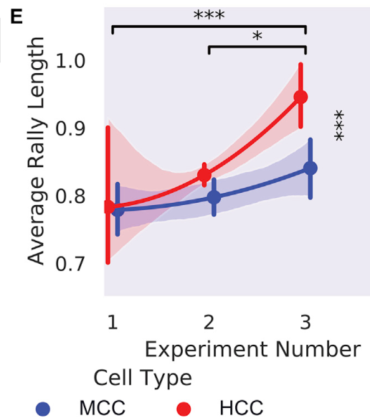
Rate coding represents ball approach
A rate code represents a variable through the frequency of events. DishBrain's final encoding combined the location of stimulation with a pulse rate that increased from 4 to 40 Hz as the ball approached the paddle. Vertical position and approach were consequently represented by different input properties.
Earlier pilot configurations used a 4-Hz place code without the additional approach-dependent rate signal. The final combined encoding produced longer average rallies than the earlier configurations. Increasing the information available through the interface changed the cultures' task performance.
Approach-dependent stimulation connected temporal urgency to neural input. As the ball neared the paddle, the network received pulses more frequently while the stimulating site continued to report vertical position. Successful interception thus depended on coordinating output with both where the ball was and how close it was to the paddle boundary.
Kagan et al. (2022), Fig. 4E. Performance across progressively richer input encodings.
Kagan et al. (2022)
10
Notes:
• A rate code represents a variable through the frequency of events. DishBrain's final encoding combined the location of stimulation with a pulse rate that increased from 4 to 40 Hz as the ball approached the paddle. Vertical position and approach were consequently represented by different input properties.
• Earlier pilot configurations used a 4-Hz place code without the additional approach-dependent rate signal. The final combined encoding produced longer average rallies than the earlier configurations. Increasing the information available through the interface changed the cultures' task performance.
• Approach-dependent stimulation connected temporal urgency to neural input. As the ball neared the paddle, the network received pulses more frequently while the stimulating site continued to report vertical position. Successful interception thus depended on coordinating output with both where the ball was and how close it was to the paddle boundary.
References:
Kagan BJ; Kitchen AC; Tran NT; Habibollahi F; Khajehnejad M; Parker BJ; Bhat A; Rollo B; Razi A; Friston KJ (2022). In vitro neurons learn and exhibit sentience when embodied in a simulated game-world. Neuron 110(23):3952–3969.e8. https://doi.org/10.1016/j.neuron.2022.09.001
Figure: Kagan et al. (2022), Fig. 4E. Performance across progressively richer input encodings.
Figure source: https://doi.org/10.1016/j.neuron.2022.09.001

Slide 11
Motor-zone activity becomes paddle displacement
A decoder converts recorded neural activity into an output command. DishBrain divided recording sites into assigned motor regions. Activity in one output group moved the paddle upward, and activity in the opposing group moved it downward.
The software used the difference between activity in these regions, with normalization for baseline differences, to determine movement. The decoder operated rapidly enough to return updated stimulation with an approximately 5-ms spike-to-stimulation latency. Neural events could therefore affect the ongoing interaction before the environment changed substantially.
These output regions were operational assignments on the array, rather than anatomical motor cortex subdivisions. Their biological activity acquired action significance through the interface. A favorable output pattern moved the paddle toward the ball, changing whether the next event was a successful return or a miss.
Kagan et al. (2022), Fig. 4D. Assigned sensory and opposing motor electrode regions.
Kagan et al. (2022)
11
Notes:
• A decoder converts recorded neural activity into an output command. DishBrain divided recording sites into assigned motor regions. Activity in one output group moved the paddle upward, and activity in the opposing group moved it downward.
• The software used the difference between activity in these regions, with normalization for baseline differences, to determine movement. The decoder operated rapidly enough to return updated stimulation with an approximately 5-ms spike-to-stimulation latency. Neural events could therefore affect the ongoing interaction before the environment changed substantially.
• These output regions were operational assignments on the array, rather than anatomical motor cortex subdivisions. Their biological activity acquired action significance through the interface. A favorable output pattern moved the paddle toward the ball, changing whether the next event was a successful return or a miss.
References:
Kagan BJ; Kitchen AC; Tran NT; Habibollahi F; Khajehnejad M; Parker BJ; Bhat A; Rollo B; Razi A; Friston KJ (2022). In vitro neurons learn and exhibit sentience when embodied in a simulated game-world. Neuron 110(23):3952–3969.e8. https://doi.org/10.1016/j.neuron.2022.09.001
Figure: Kagan et al. (2022), Fig. 4D. Assigned sensory and opposing motor electrode regions.
Figure source: https://doi.org/10.1016/j.neuron.2022.09.001

Slide 12
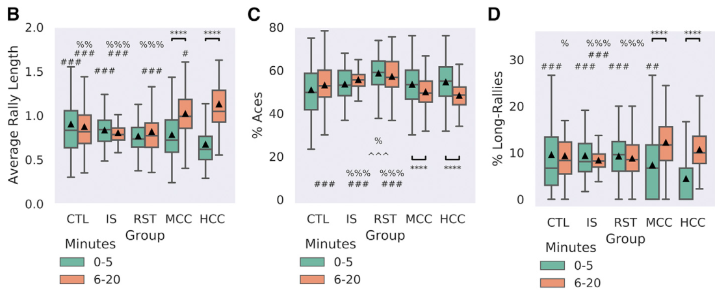
Rally length measures sustained successful control
A rally is a sequence of successful paddle returns before a miss. Average rally length measures how long a culture maintains the required sensorimotor relationship. The analysis compared the first 5 min with the remaining 15 min of a gameplay session.
Human and mouse cortical cultures increased rally length during gameplay. The investigators also measured immediate failures, called aces, and extended sequences of returns, called long rallies. These additional measures distinguished sustained interception from isolated successful contacts.
The task metrics describe the performance of the complete culture-interface system. A longer rally requires repeated appropriate output as ball position changes, rather than a single favorable paddle location. Reductions in immediate failure and increases in sustained returns provide complementary descriptions of adaptation to the task's changing sensory demands.
Kagan et al. (2022), Fig. 5B–D. Rally length, missed first returns, and long rallies.
Kagan et al. (2022)
12
Notes:
• A rally is a sequence of successful paddle returns before a miss. Average rally length measures how long a culture maintains the required sensorimotor relationship. The analysis compared the first 5 min with the remaining 15 min of a gameplay session.
• Human and mouse cortical cultures increased rally length during gameplay. The investigators also measured immediate failures, called aces, and extended sequences of returns, called long rallies. These additional measures distinguished sustained interception from isolated successful contacts.
• The task metrics describe the performance of the complete culture-interface system. A longer rally requires repeated appropriate output as ball position changes, rather than a single favorable paddle location. Reductions in immediate failure and increases in sustained returns provide complementary descriptions of adaptation to the task's changing sensory demands.
References:
Kagan BJ; Kitchen AC; Tran NT; Habibollahi F; Khajehnejad M; Parker BJ; Bhat A; Rollo B; Razi A; Friston KJ (2022). In vitro neurons learn and exhibit sentience when embodied in a simulated game-world. Neuron 110(23):3952–3969.e8. https://doi.org/10.1016/j.neuron.2022.09.001
Figure: Kagan et al. (2022), Fig. 5B–D. Rally length, missed first returns, and long rallies.
Figure source: https://doi.org/10.1016/j.neuron.2022.09.001

Slide 13
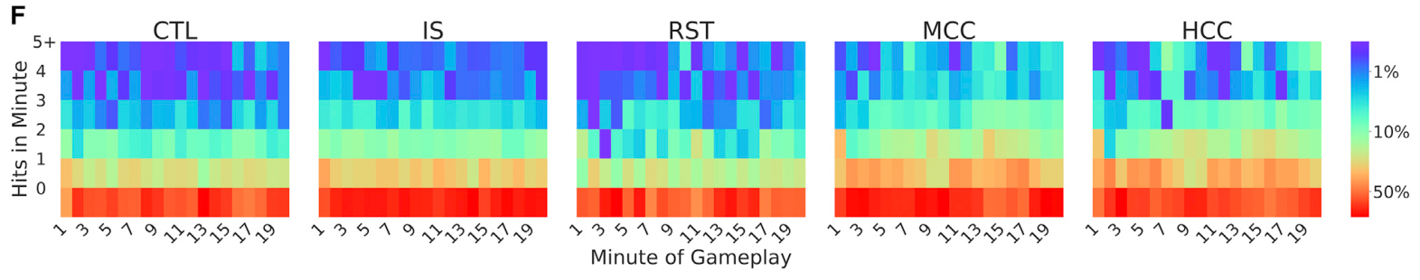
Controls distinguish adaptation from movement
Kagan and colleagues compared living cultures with media-only arrays, random-output simulations, and a rest condition in which culture activity moved the paddle without sensory stimulation. These controls tested whether electrode artifacts, random commands, or spontaneous activity could generate comparable performance changes.
Only the mouse and human cortical gameplay groups increased their average rally length over the session. The human cultures initially performed poorly but later exceeded the control groups. Improvement was therefore related to interaction with the structured task, rather than simply to producing electrical activity.
The controls separate paddle movement from adaptive control. A randomly or spontaneously driven paddle can sometimes intercept the ball, but repeated appropriate returns require an output pattern related to changing input. The distribution of returns shifted during biological gameplay as the cultures adjusted their responses.
Kagan et al. (2022), Fig. 5F. Distribution of return counts across gameplay time.
Kagan et al. (2022)
13
Notes:
• Kagan and colleagues compared living cultures with media-only arrays, random-output simulations, and a rest condition in which culture activity moved the paddle without sensory stimulation. These controls tested whether electrode artifacts, random commands, or spontaneous activity could generate comparable performance changes.
• Only the mouse and human cortical gameplay groups increased their average rally length over the session. The human cultures initially performed poorly but later exceeded the control groups. Improvement was therefore related to interaction with the structured task, rather than simply to producing electrical activity.
• The controls separate paddle movement from adaptive control. A randomly or spontaneously driven paddle can sometimes intercept the ball, but repeated appropriate returns require an output pattern related to changing input. The distribution of returns shifted during biological gameplay as the cultures adjusted their responses.
References:
Kagan BJ; Kitchen AC; Tran NT; Habibollahi F; Khajehnejad M; Parker BJ; Bhat A; Rollo B; Razi A; Friston KJ (2022). In vitro neurons learn and exhibit sentience when embodied in a simulated game-world. Neuron 110(23):3952–3969.e8. https://doi.org/10.1016/j.neuron.2022.09.001
Figure: Kagan et al. (2022), Fig. 5F. Distribution of return counts across gameplay time.
Figure source: https://doi.org/10.1016/j.neuron.2022.09.001

Slide 14
Hits and misses change stimulation
Outcome-contingent feedback changes according to the consequence of an action. A successful Pong return produced a brief predictable stimulus, delivered across electrodes at 100 Hz. The game then continued with the ball's subsequent trajectory.
A missed return produced an unpredictable stimulation period at 5 Hz for 4 s, followed by a restart in a random direction. The two outcomes therefore differed in stimulation pattern, duration, and continuity of the game. These were electrical consequences, without an added chemical reward.
The authors' active-inference hypothesis proposes that cultures adapt toward more predictable input by changing their output. Active inference is a framework in which action and internal adjustment reduce mismatch between expected and received input. The experimental evidence supporting adaptation consists of the task results and feedback comparisons, rather than the hypothesis alone.
Kagan et al. (2022), Fig. 6A. Outcome-dependent stimulation across three feedback conditions.
Kagan et al. (2022)
14
Notes:
• Outcome-contingent feedback changes according to the consequence of an action. A successful Pong return produced a brief predictable stimulus, delivered across electrodes at 100 Hz. The game then continued with the ball's subsequent trajectory.
• A missed return produced an unpredictable stimulation period at 5 Hz for 4 s, followed by a restart in a random direction. The two outcomes therefore differed in stimulation pattern, duration, and continuity of the game. These were electrical consequences, without an added chemical reward.
• The authors' active-inference hypothesis proposes that cultures adapt toward more predictable input by changing their output. Active inference is a framework in which action and internal adjustment reduce mismatch between expected and received input. The experimental evidence supporting adaptation consists of the task results and feedback comparisons, rather than the hypothesis alone.
References:
Kagan BJ; Kitchen AC; Tran NT; Habibollahi F; Khajehnejad M; Parker BJ; Bhat A; Rollo B; Razi A; Friston KJ (2022). In vitro neurons learn and exhibit sentience when embodied in a simulated game-world. Neuron 110(23):3952–3969.e8. https://doi.org/10.1016/j.neuron.2022.09.001
Figure: Kagan et al. (2022), Fig. 6A. Outcome-dependent stimulation across three feedback conditions.
Figure source: https://doi.org/10.1016/j.neuron.2022.09.001

Slide 15
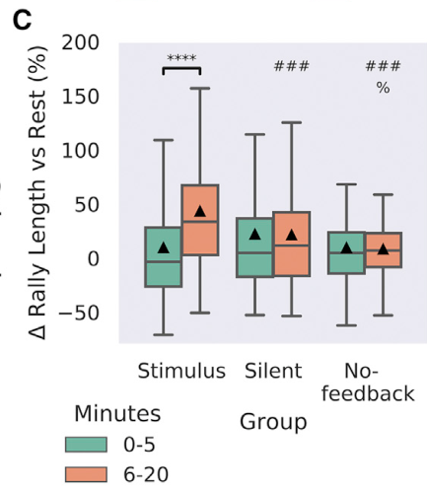
Feedback changes the learning outcome
The no-feedback condition retained stimulation reporting ball position but removed the outcome-dependent restart. After a miss, the ball continued without an interruption that distinguished failure from successful control. The culture received task information without the usual consequence of a missed return.
In the silent condition, missed returns led to a matching period without stimulation before the game restarted. This manipulation retained a consequence of failure while changing its electrical content. The stimulus condition retained the predictable and unpredictable stimulation schedule.
Within-session rally-length improvement was strongest under the stimulus-feedback condition. Silent feedback supported higher later performance than the no-feedback condition. The comparison connects adaptation to outcome-dependent changes in the input sequence: continued ball-position stimulation and feedback contingent on failure produced different performance trajectories.
Kagan et al. (2022), Fig. 6C. Changes in rally length under feedback manipulations.
Kagan et al. (2022)
15
Notes:
• The no-feedback condition retained stimulation reporting ball position but removed the outcome-dependent restart. After a miss, the ball continued without an interruption that distinguished failure from successful control. The culture received task information without the usual consequence of a missed return.
• In the silent condition, missed returns led to a matching period without stimulation before the game restarted. This manipulation retained a consequence of failure while changing its electrical content. The stimulus condition retained the predictable and unpredictable stimulation schedule.
• Within-session rally-length improvement was strongest under the stimulus-feedback condition. Silent feedback supported higher later performance than the no-feedback condition. The comparison connects adaptation to outcome-dependent changes in the input sequence: continued ball-position stimulation and feedback contingent on failure produced different performance trajectories.
References:
Kagan BJ; Kitchen AC; Tran NT; Habibollahi F; Khajehnejad M; Parker BJ; Bhat A; Rollo B; Razi A; Friston KJ (2022). In vitro neurons learn and exhibit sentience when embodied in a simulated game-world. Neuron 110(23):3952–3969.e8. https://doi.org/10.1016/j.neuron.2022.09.001
Figure: Kagan et al. (2022), Fig. 6C. Changes in rally length under feedback manipulations.
Figure source: https://doi.org/10.1016/j.neuron.2022.09.001

Slide 16
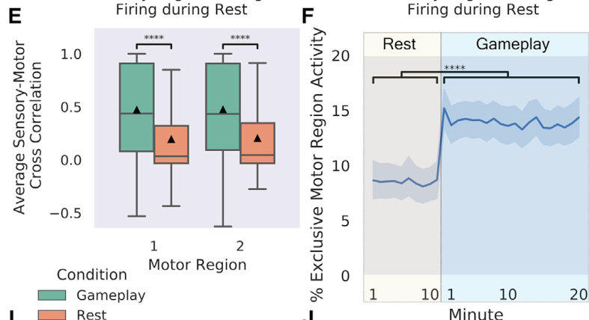
Gameplay separates opposing output activity
Population coordination describes relationships among neural activity recorded at different sites. Kagan and colleagues compared activity in sensory and motor regions during rest and gameplay. Sensory-motor correlations were lower during gameplay than during spontaneous rest activity.
The opposing motor regions also produced more mutually exclusive activity during gameplay. A mutually exclusive event occurs when one output region is active without simultaneous activity in its opponent. Such events generate a directional command rather than canceling through opposing output.
The change links population activity to the decoder's requirements. Broadly synchronized firing can activate both output groups together, whereas differentiated activity produces a clearer upward or downward command. Task engagement reorganized the relationships among recorded populations in a direction relevant to control of the paddle.
Kagan et al. (2022), Fig. 7E–F. Sensory-motor correlation and mutually exclusive output activity.
Kagan et al. (2022)
16
Notes:
• Population coordination describes relationships among neural activity recorded at different sites. Kagan and colleagues compared activity in sensory and motor regions during rest and gameplay. Sensory-motor correlations were lower during gameplay than during spontaneous rest activity.
• The opposing motor regions also produced more mutually exclusive activity during gameplay. A mutually exclusive event occurs when one output region is active without simultaneous activity in its opponent. Such events generate a directional command rather than canceling through opposing output.
• The change links population activity to the decoder's requirements. Broadly synchronized firing can activate both output groups together, whereas differentiated activity produces a clearer upward or downward command. Task engagement reorganized the relationships among recorded populations in a direction relevant to control of the paddle.
References:
Kagan BJ; Kitchen AC; Tran NT; Habibollahi F; Khajehnejad M; Parker BJ; Bhat A; Rollo B; Razi A; Friston KJ (2022). In vitro neurons learn and exhibit sentience when embodied in a simulated game-world. Neuron 110(23):3952–3969.e8. https://doi.org/10.1016/j.neuron.2022.09.001
Figure: Kagan et al. (2022), Fig. 7E–F. Sensory-motor correlation and mutually exclusive output activity.
Figure source: https://doi.org/10.1016/j.neuron.2022.09.001

Slide 17
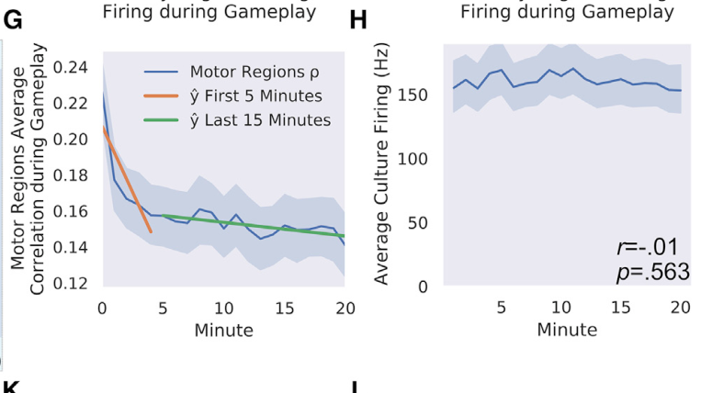
Coordination changes without increased firing
Synchrony is coordinated activity occurring at the same time across recorded populations. During DishBrain gameplay, the correlation between opposing motor regions changed markedly near the beginning of a session. The relationship evolved as cultures interacted with the input-output mapping.
The study also assessed average culture firing across the session. Overall firing magnitude lacked the same learning-related trend, even while the relationships among output regions changed. Adaptation therefore involved the distribution and coordination of activity, rather than simply increasing the total number of spikes.
This distinction connects the scale of measurement to function. A culture can maintain a similar overall activity level while reorganizing which populations are active together. Because the paddle decoder compares opposing regions, changes in their coordination can alter action selection even when aggregate firing remains relatively stable.
Kagan et al. (2022), Fig. 7G–H. Time-dependent correlation between opposing motor regions.
Kagan et al. (2022)
17
Notes:
• Synchrony is coordinated activity occurring at the same time across recorded populations. During DishBrain gameplay, the correlation between opposing motor regions changed markedly near the beginning of a session. The relationship evolved as cultures interacted with the input-output mapping.
• The study also assessed average culture firing across the session. Overall firing magnitude lacked the same learning-related trend, even while the relationships among output regions changed. Adaptation therefore involved the distribution and coordination of activity, rather than simply increasing the total number of spikes.
• This distinction connects the scale of measurement to function. A culture can maintain a similar overall activity level while reorganizing which populations are active together. Because the paddle decoder compares opposing regions, changes in their coordination can alter action selection even when aggregate firing remains relatively stable.
References:
Kagan BJ; Kitchen AC; Tran NT; Habibollahi F; Khajehnejad M; Parker BJ; Bhat A; Rollo B; Razi A; Friston KJ (2022). In vitro neurons learn and exhibit sentience when embodied in a simulated game-world. Neuron 110(23):3952–3969.e8. https://doi.org/10.1016/j.neuron.2022.09.001
Figure: Kagan et al. (2022), Fig. 7G–H. Time-dependent correlation between opposing motor regions.
Figure source: https://doi.org/10.1016/j.neuron.2022.09.001

Slide 18
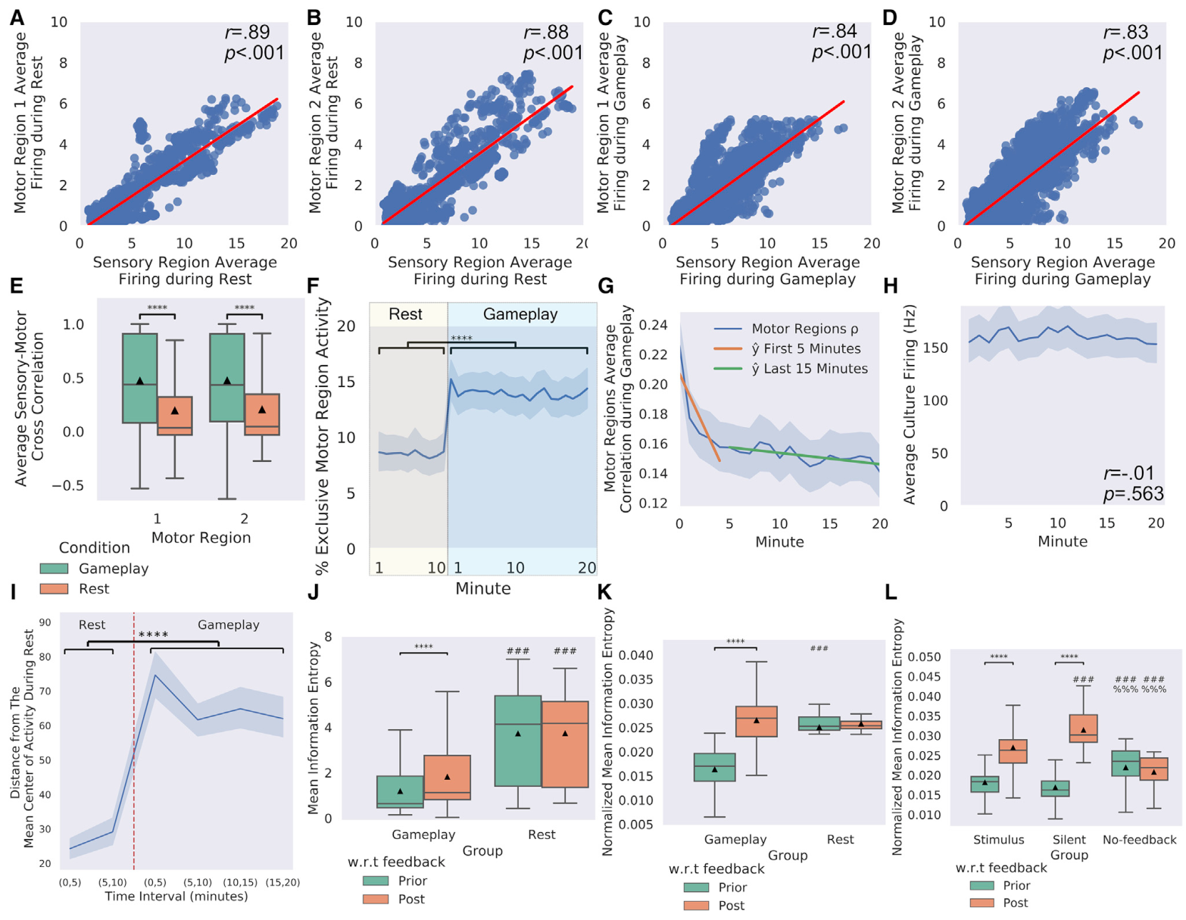
Feedback changes activity entropy
Information entropy quantifies uncertainty in a probability distribution. Kagan and colleagues estimated entropy from recorded neural activity, comparing periods before and after feedback. This measure describes the distribution of electrical events rather than an experienced emotional state.
Unpredictable stimulation increased the activity-based entropy measure after missed returns during gameplay. Matched resting periods lacked the same feedback-related change. The stimulus and silent feedback conditions also differed from the condition retaining ball information without outcome-dependent interruption.
These results connect the structure of external input to the organization of population activity. A miss altered the stimulation sequence and was followed by a changed distribution of neural events. Feedback consequently affected both the environment presented to the network and the electrical activity from which subsequent paddle commands were decoded.
Kagan et al. (2022), Fig. 7A–L. Activity entropy before and after feedback.
Kagan et al. (2022)
18
Notes:
• Information entropy quantifies uncertainty in a probability distribution. Kagan and colleagues estimated entropy from recorded neural activity, comparing periods before and after feedback. This measure describes the distribution of electrical events rather than an experienced emotional state.
• Unpredictable stimulation increased the activity-based entropy measure after missed returns during gameplay. Matched resting periods lacked the same feedback-related change. The stimulus and silent feedback conditions also differed from the condition retaining ball information without outcome-dependent interruption.
• These results connect the structure of external input to the organization of population activity. A miss altered the stimulation sequence and was followed by a changed distribution of neural events. Feedback consequently affected both the environment presented to the network and the electrical activity from which subsequent paddle commands were decoded.
References:
Kagan BJ; Kitchen AC; Tran NT; Habibollahi F; Khajehnejad M; Parker BJ; Bhat A; Rollo B; Razi A; Friston KJ (2022). In vitro neurons learn and exhibit sentience when embodied in a simulated game-world. Neuron 110(23):3952–3969.e8. https://doi.org/10.1016/j.neuron.2022.09.001
Figure: Kagan et al. (2022), Fig. 7A–L. Activity entropy before and after feedback.
Figure source: https://doi.org/10.1016/j.neuron.2022.09.001

Slide 19
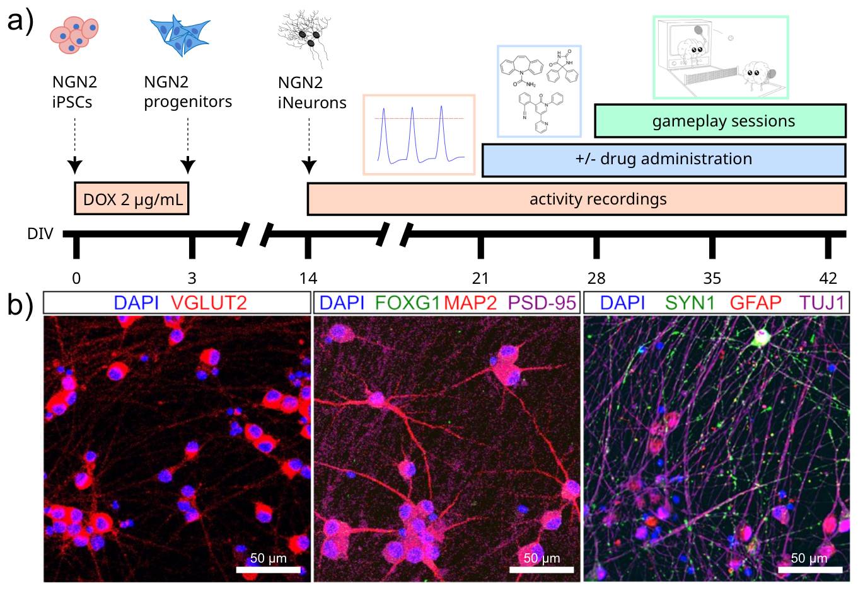
NGN2 creates an excitatory preparation
Watmuff and colleagues used human neurons generated by inducible expression of neurogenin 2, or NGN2, a transcription factor that promotes neuronal differentiation. A transcription factor changes gene expression by influencing transcription, the production of RNA from DNA.
The resulting cultures expressed markers associated with glutamatergic neurons. Glutamate is an excitatory neurotransmitter, a chemical signal released by neurons that can increase the activity of receiving cells. A synapse is a site of communication between neurons. Vesicular glutamate transporter 2, or VGLUT2, packages glutamate into synaptic vesicles, membrane-bound structures that store transmitter for release.
The cultures were supplemented with astrocytes but lacked a balanced complement of inhibitory interneurons. They developed high spontaneous activity and synchronized bursts. This preparation made reduction of excessive excitability a relevant intervention, connecting cellular composition to the operating state of the network before pharmacological testing.
Watmuff et al. (2025), Fig. 1A–B. Neuronal and synaptic markers in the NGN2 culture.
Watmuff et al. (2025)
19
Notes:
• Watmuff and colleagues used human neurons generated by inducible expression of neurogenin 2, or NGN2, a transcription factor that promotes neuronal differentiation. A transcription factor changes gene expression by influencing transcription, the production of RNA from DNA.
• The resulting cultures expressed markers associated with glutamatergic neurons. Glutamate is an excitatory neurotransmitter, a chemical signal released by neurons that can increase the activity of receiving cells. A synapse is a site of communication between neurons. Vesicular glutamate transporter 2, or VGLUT2, packages glutamate into synaptic vesicles, membrane-bound structures that store transmitter for release.
• The cultures were supplemented with astrocytes but lacked a balanced complement of inhibitory interneurons. They developed high spontaneous activity and synchronized bursts. This preparation made reduction of excessive excitability a relevant intervention, connecting cellular composition to the operating state of the network before pharmacological testing.
References:
Watmuff B; Habibollahi F; Desouza C; Khajehnejad M; Loeffler A; Baranes K; Poulin N; Kotter M; Kagan BJ (2025). Drug treatment alters performance in a neural microphysiological system of information processing. Communications Biology 8:916. https://doi.org/10.1038/s42003-025-08194-6
Figure: Watmuff et al. (2025), Fig. 1A–B. Neuronal and synaptic markers in the NGN2 culture.
Figure source: https://doi.org/10.1038/s42003-025-08194-6

Slide 20
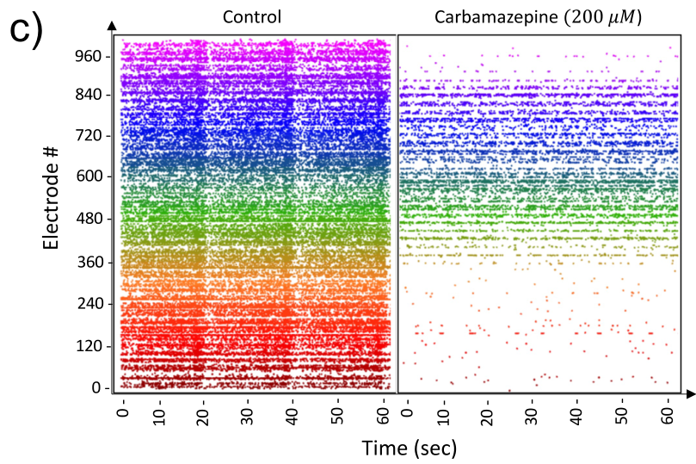
Hyperactivity changes the network's operating state
A burst is a cluster of spikes occurring close together in time. NGN2-derived cultures exhibited substantial spontaneous firing and coordinated network bursts. Such activity can repeatedly recruit large portions of the preparation, reducing the separation between activity in different output populations.
Watmuff and colleagues measured spontaneous activity alongside behavior in the Pong interface. This paired assay distinguished a drug's effect on baseline excitability from its effect on information processing during interaction with structured input. Recordings began from day 21 of differentiation.
Carbamazepine changed the raster pattern and reduced firing at the tested high concentration. A raster represents recorded spikes by their occurrence time and recording site. Pharmacological adjustment therefore altered the biological state entering the feedback loop, while the task interface supplied a separate measure of how that state supported control.
Watmuff et al. (2025), Fig. 1C. Population firing before and after carbamazepine.
Watmuff et al. (2025)
20
Notes:
• A burst is a cluster of spikes occurring close together in time. NGN2-derived cultures exhibited substantial spontaneous firing and coordinated network bursts. Such activity can repeatedly recruit large portions of the preparation, reducing the separation between activity in different output populations.
• Watmuff and colleagues measured spontaneous activity alongside behavior in the Pong interface. This paired assay distinguished a drug's effect on baseline excitability from its effect on information processing during interaction with structured input. Recordings began from day 21 of differentiation.
• Carbamazepine changed the raster pattern and reduced firing at the tested high concentration. A raster represents recorded spikes by their occurrence time and recording site. Pharmacological adjustment therefore altered the biological state entering the feedback loop, while the task interface supplied a separate measure of how that state supported control.
References:
Watmuff B; Habibollahi F; Desouza C; Khajehnejad M; Loeffler A; Baranes K; Poulin N; Kotter M; Kagan BJ (2025). Drug treatment alters performance in a neural microphysiological system of information processing. Communications Biology 8:916. https://doi.org/10.1038/s42003-025-08194-6
Figure: Watmuff et al. (2025), Fig. 1C. Population firing before and after carbamazepine.
Figure source: https://doi.org/10.1038/s42003-025-08194-6

Slide 21
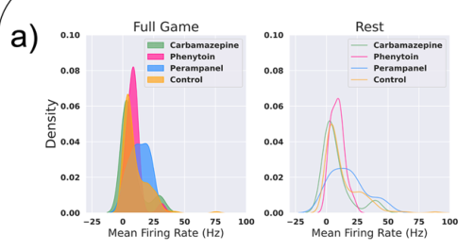
Anti-seizure drugs alter firing differently
Pharmacological modulation changes neural activity by applying a compound that acts on molecular targets. The study tested carbamazepine at 2–200 µM, phenytoin at 10–33 µM, and perampanel at 1–10 µM. A micromolar concentration describes the amount of dissolved compound per unit volume.
The compounds produced different firing-rate profiles in the NGN2 cultures. Carbamazepine reduced mean firing with increasing concentration, whereas the other treatments changed activity differently under the tested conditions. The effects depended on the interaction between drug target, dose, and network state.
Rest and gameplay exposed the cultures to different input conditions. Comparing both states connected spontaneous excitability with activity during task engagement. A compound's effect on baseline firing was consequently one part of its physiological profile, alongside the pattern of activity expressed during closed-loop stimulation.
Watmuff et al. (2025), Fig. 2A. Firing-rate distributions at rest and during gameplay.
Watmuff et al. (2025)
21
Notes:
• Pharmacological modulation changes neural activity by applying a compound that acts on molecular targets. The study tested carbamazepine at 2–200 µM, phenytoin at 10–33 µM, and perampanel at 1–10 µM. A micromolar concentration describes the amount of dissolved compound per unit volume.
• The compounds produced different firing-rate profiles in the NGN2 cultures. Carbamazepine reduced mean firing with increasing concentration, whereas the other treatments changed activity differently under the tested conditions. The effects depended on the interaction between drug target, dose, and network state.
• Rest and gameplay exposed the cultures to different input conditions. Comparing both states connected spontaneous excitability with activity during task engagement. A compound's effect on baseline firing was consequently one part of its physiological profile, alongside the pattern of activity expressed during closed-loop stimulation.
References:
Watmuff B; Habibollahi F; Desouza C; Khajehnejad M; Loeffler A; Baranes K; Poulin N; Kotter M; Kagan BJ (2025). Drug treatment alters performance in a neural microphysiological system of information processing. Communications Biology 8:916. https://doi.org/10.1038/s42003-025-08194-6
Figure: Watmuff et al. (2025), Fig. 2A. Firing-rate distributions at rest and during gameplay.
Figure source: https://doi.org/10.1038/s42003-025-08194-6

Slide 22
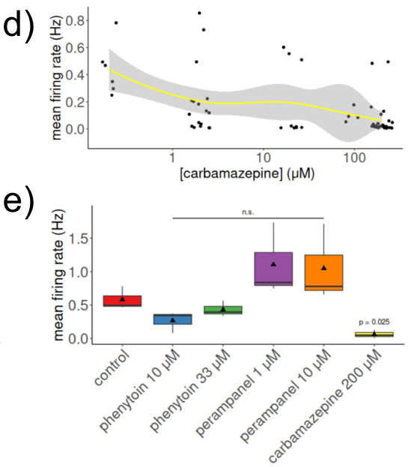
Sodium-channel blockade changes spike generation
Voltage-gated sodium channels are membrane proteins that open in response to depolarization, a reduction in the electrical voltage difference across the membrane. Sodium entry through these channels contributes to the rapid rising phase of an action potential, the electrical event recorded as a spike.
Carbamazepine and phenytoin act on neuronal sodium channels. Altering channel availability changes the ability of neurons to generate and sustain activity. In the NGN2 preparation, increasing carbamazepine concentration reduced average firing, linking its molecular target to a measurable network response.
At 200 µM, carbamazepine also improved gameplay measures. The same compound therefore changed both excitability and task performance in this preparation. The task result links channel modulation to network-level control through the activity entering the paddle decoder, rather than treating lower firing as a sufficient behavioral outcome by itself.
Watmuff et al. (2025), Fig. 1D–E. Carbamazepine dose response and treatment firing rates.
Watmuff et al. (2025), Fig. 1A–B. Differentiation and neuronal tissue markers.
Watmuff et al. (2025)
22
Notes:
• Voltage-gated sodium channels are membrane proteins that open in response to depolarization, a reduction in the electrical voltage difference across the membrane. Sodium entry through these channels contributes to the rapid rising phase of an action potential, the electrical event recorded as a spike.
• Carbamazepine and phenytoin act on neuronal sodium channels. Altering channel availability changes the ability of neurons to generate and sustain activity. In the NGN2 preparation, increasing carbamazepine concentration reduced average firing, linking its molecular target to a measurable network response.
• At 200 µM, carbamazepine also improved gameplay measures. The same compound therefore changed both excitability and task performance in this preparation. The task result links channel modulation to network-level control through the activity entering the paddle decoder, rather than treating lower firing as a sufficient behavioral outcome by itself.
References:
Watmuff B; Habibollahi F; Desouza C; Khajehnejad M; Loeffler A; Baranes K; Poulin N; Kotter M; Kagan BJ (2025). Drug treatment alters performance in a neural microphysiological system of information processing. Communications Biology 8:916. https://doi.org/10.1038/s42003-025-08194-6
Figure: Watmuff et al. (2025), Fig. 1D–E. Carbamazepine dose response and treatment firing rates.
Figure source: https://doi.org/10.1038/s42003-025-08194-6
Figure: Watmuff et al. (2025), Fig. 1A–B. Differentiation and neuronal tissue markers.
Figure source: https://doi.org/10.1038/s42003-025-08194-6

Slide 23
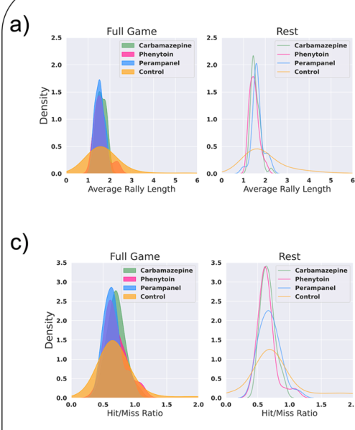
AMPA blockade alters synaptic recruitment
An AMPA receptor is an ion-conducting glutamate receptor on a receiving cell. Glutamate binding recruits excitatory synaptic current, connecting transmitter release to changes in membrane voltage and the probability of subsequent firing. Repeated synaptic recruitment helps propagate activity through a network.
Perampanel is a noncompetitive AMPA receptor antagonist. An antagonist reduces a receptor's activity; noncompetitive action means that its inhibitory effect is not produced by simply competing with glutamate for the same binding site. Its target differs from the sodium channels acted on by carbamazepine and phenytoin.
The drug study compared these distinct interventions using both electrophysiology and gameplay. Perampanel changed neural activity but did not produce the same task improvement as high-dose carbamazepine. Effects on excitatory transmission and effects on spike-generating channels therefore yielded different functional outcomes under the tested culture conditions.
Watmuff et al. (2025), Fig. 3A,C. Rally-length and hit-to-miss distributions.
Watmuff et al. (2025), Fig. 1A–B. Differentiation and neuronal tissue markers.
Watmuff et al. (2025)
23
Notes:
• An AMPA receptor is an ion-conducting glutamate receptor on a receiving cell. Glutamate binding recruits excitatory synaptic current, connecting transmitter release to changes in membrane voltage and the probability of subsequent firing. Repeated synaptic recruitment helps propagate activity through a network.
• Perampanel is a noncompetitive AMPA receptor antagonist. An antagonist reduces a receptor's activity; noncompetitive action means that its inhibitory effect is not produced by simply competing with glutamate for the same binding site. Its target differs from the sodium channels acted on by carbamazepine and phenytoin.
• The drug study compared these distinct interventions using both electrophysiology and gameplay. Perampanel changed neural activity but did not produce the same task improvement as high-dose carbamazepine. Effects on excitatory transmission and effects on spike-generating channels therefore yielded different functional outcomes under the tested culture conditions.
References:
Watmuff B; Habibollahi F; Desouza C; Khajehnejad M; Loeffler A; Baranes K; Poulin N; Kotter M; Kagan BJ (2025). Drug treatment alters performance in a neural microphysiological system of information processing. Communications Biology 8:916. https://doi.org/10.1038/s42003-025-08194-6
Figure: Watmuff et al. (2025), Fig. 3A,C. Rally-length and hit-to-miss distributions.
Figure source: https://doi.org/10.1038/s42003-025-08194-6
Figure: Watmuff et al. (2025), Fig. 1A–B. Differentiation and neuronal tissue markers.
Figure source: https://doi.org/10.1038/s42003-025-08194-6

Slide 24
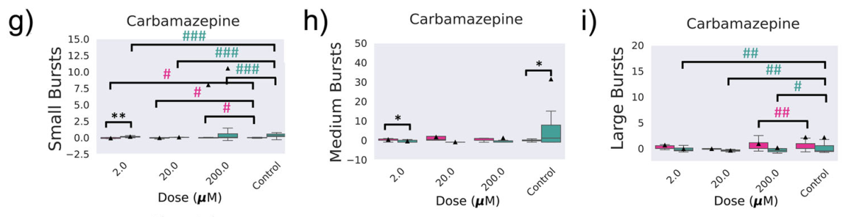
Carbamazepine changes burst structure
Watmuff and colleagues divided network bursts into small, medium, and large classes according to their recorded size. Burst size describes the amount of activity recruited within a temporally clustered network event. Different sizes represent different degrees of population recruitment.
The counts of these burst classes changed under pharmacological intervention and differed between rest and gameplay. Small bursts decreased during gameplay relative to rest in the tested groups. Carbamazepine also changed the distribution of larger events, with its effects varying across concentration.
The classification distinguishes a network's organization from its average rate. Two conditions with similar overall firing can differ in whether spikes occur in many small events or fewer broadly recruited events. Drug effects on burst structure therefore describe how activity is assembled into population events during interaction with the game.
Watmuff et al. (2025), Fig. 4G–I. Small, medium, and large bursts across carbamazepine doses.
Watmuff et al. (2025)
24
Notes:
• Watmuff and colleagues divided network bursts into small, medium, and large classes according to their recorded size. Burst size describes the amount of activity recruited within a temporally clustered network event. Different sizes represent different degrees of population recruitment.
• The counts of these burst classes changed under pharmacological intervention and differed between rest and gameplay. Small bursts decreased during gameplay relative to rest in the tested groups. Carbamazepine also changed the distribution of larger events, with its effects varying across concentration.
• The classification distinguishes a network's organization from its average rate. Two conditions with similar overall firing can differ in whether spikes occur in many small events or fewer broadly recruited events. Drug effects on burst structure therefore describe how activity is assembled into population events during interaction with the game.
References:
Watmuff B; Habibollahi F; Desouza C; Khajehnejad M; Loeffler A; Baranes K; Poulin N; Kotter M; Kagan BJ (2025). Drug treatment alters performance in a neural microphysiological system of information processing. Communications Biology 8:916. https://doi.org/10.1038/s42003-025-08194-6
Figure: Watmuff et al. (2025), Fig. 4G–I. Small, medium, and large bursts across carbamazepine doses.
Figure source: https://doi.org/10.1038/s42003-025-08194-6

Slide 25
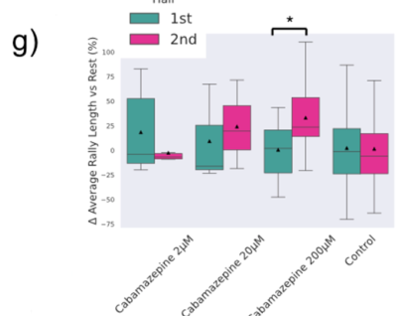
Carbamazepine improves task performance
At 200 µM, carbamazepine improved average rally length in the NGN2 culture assay. The treatment group also produced more successful returns and fewer immediate failures than untreated cultures and other tested treatments. The measured behavior was control of a simulated paddle through neural output.
The experiment compared the first and second halves of 15-min recordings. Only the high-dose carbamazepine condition showed clear improvement over time in average rally length normalized to rest performance. Untreated cultures lacked the same within-session learning effect in this preparation.
Network operating state refers to the pattern of excitability and coordinated activity present under particular conditions. The authors propose that excessive excitability limited useful processing in the untreated cultures. Carbamazepine's joint effects on firing and gameplay connect adjustment of that state with improved adaptive performance under the assay's stimulation and decoding rules.
Watmuff et al. (2025), Fig. 3G. Within-session rally changes under carbamazepine.
Watmuff et al. (2025)
25
Notes:
• At 200 µM, carbamazepine improved average rally length in the NGN2 culture assay. The treatment group also produced more successful returns and fewer immediate failures than untreated cultures and other tested treatments. The measured behavior was control of a simulated paddle through neural output.
• The experiment compared the first and second halves of 15-min recordings. Only the high-dose carbamazepine condition showed clear improvement over time in average rally length normalized to rest performance. Untreated cultures lacked the same within-session learning effect in this preparation.
• Network operating state refers to the pattern of excitability and coordinated activity present under particular conditions. The authors propose that excessive excitability limited useful processing in the untreated cultures. Carbamazepine's joint effects on firing and gameplay connect adjustment of that state with improved adaptive performance under the assay's stimulation and decoding rules.
References:
Watmuff B; Habibollahi F; Desouza C; Khajehnejad M; Loeffler A; Baranes K; Poulin N; Kotter M; Kagan BJ (2025). Drug treatment alters performance in a neural microphysiological system of information processing. Communications Biology 8:916. https://doi.org/10.1038/s42003-025-08194-6
Figure: Watmuff et al. (2025), Fig. 3G. Within-session rally changes under carbamazepine.
Figure source: https://doi.org/10.1038/s42003-025-08194-6

Slide 26
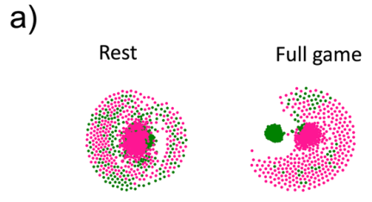
Drug effects depend on network state
The same neural culture encounters different conditions at rest and during gameplay. Spontaneous recording samples internally generated activity, whereas gameplay adds structured input and action-dependent feedback. Drug effects can therefore depend on whether the network is interacting with the task.
Watmuff and colleagues represented population activity in a reduced-dimensional space, retaining relationships among activity patterns while reducing the number of coordinates used to describe them. Early and later gameplay activity occupied more differentiated regions than corresponding resting activity in several conditions.
Carbamazepine's effects on task performance accompanied changes in network activity organization. Other drugs altered neural dynamics without producing the same improvement. Combining behavioral and electrophysiological measurements therefore connects molecular intervention to the functional consequences of activity in a specified environment, rather than assigning performance from resting firing alone.
Watmuff et al. (2025), Fig. 6A. Population activity embeddings at rest and during gameplay.
Watmuff et al. (2025)
26
Notes:
• The same neural culture encounters different conditions at rest and during gameplay. Spontaneous recording samples internally generated activity, whereas gameplay adds structured input and action-dependent feedback. Drug effects can therefore depend on whether the network is interacting with the task.
• Watmuff and colleagues represented population activity in a reduced-dimensional space, retaining relationships among activity patterns while reducing the number of coordinates used to describe them. Early and later gameplay activity occupied more differentiated regions than corresponding resting activity in several conditions.
• Carbamazepine's effects on task performance accompanied changes in network activity organization. Other drugs altered neural dynamics without producing the same improvement. Combining behavioral and electrophysiological measurements therefore connects molecular intervention to the functional consequences of activity in a specified environment, rather than assigning performance from resting firing alone.
References:
Watmuff B; Habibollahi F; Desouza C; Khajehnejad M; Loeffler A; Baranes K; Poulin N; Kotter M; Kagan BJ (2025). Drug treatment alters performance in a neural microphysiological system of information processing. Communications Biology 8:916. https://doi.org/10.1038/s42003-025-08194-6
Figure: Watmuff et al. (2025), Fig. 6A. Population activity embeddings at rest and during gameplay.
Figure source: https://doi.org/10.1038/s42003-025-08194-6

Slide 27
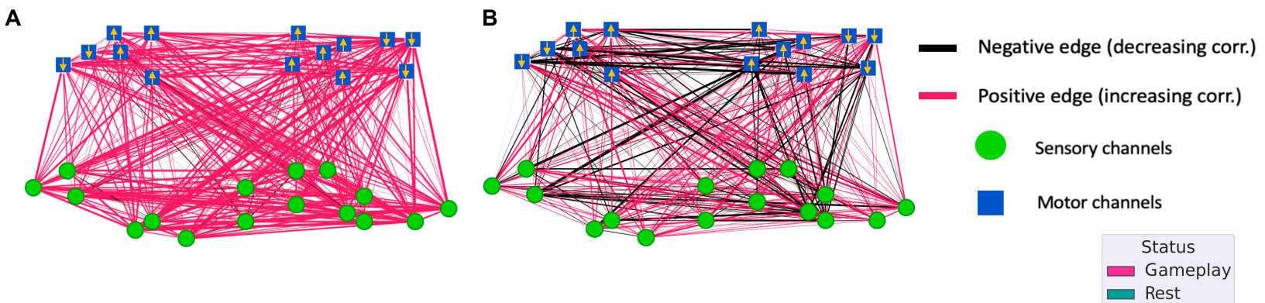
Connectivity summarizes coordinated activity
Functional connectivity is a relationship inferred from activity recorded at different sites. Khajehnejad and colleagues calculated correlations among representations of neural spiking, treating recording channels as nodes and their activity relationships as links in a network graph.
The analysis compared early and late portions of rest and gameplay recordings. Link colors indicated whether the inferred relationship increased or decreased. Gameplay produced more extensive changes in these relationships than rest, connecting environmental interaction to reorganized population activity.
A functional link is an activity relationship rather than a counted anatomical synapse. Correlated sites can share input or participate in wider network dynamics. The graph therefore describes how recorded populations function together, while its changes identify a task-associated reorganization that can be related to the biological controller's evolving output.
Khajehnejad et al. (2025), Fig. 4A–B. Changes in inferred connectivity during gameplay and rest.
Khajehnejad et al. (2025)
27
Notes:
• Functional connectivity is a relationship inferred from activity recorded at different sites. Khajehnejad and colleagues calculated correlations among representations of neural spiking, treating recording channels as nodes and their activity relationships as links in a network graph.
• The analysis compared early and late portions of rest and gameplay recordings. Link colors indicated whether the inferred relationship increased or decreased. Gameplay produced more extensive changes in these relationships than rest, connecting environmental interaction to reorganized population activity.
• A functional link is an activity relationship rather than a counted anatomical synapse. Correlated sites can share input or participate in wider network dynamics. The graph therefore describes how recorded populations function together, while its changes identify a task-associated reorganization that can be related to the biological controller's evolving output.
References:
Khajehnejad M; Habibollahi F; Loeffler A; Paul A; Razi A; Kagan BJ (2025). Dynamic Network Plasticity and Sample Efficiency in Biological Neural Cultures: A Comparative Study with Deep Reinforcement Learning. Cyborg and Bionic Systems 6:0336. https://doi.org/10.34133/cbsystems.0336
Figure: Khajehnejad et al. (2025), Fig. 4A–B. Changes in inferred connectivity during gameplay and rest.
Figure source: https://doi.org/10.34133/cbsystems.0336

Slide 28
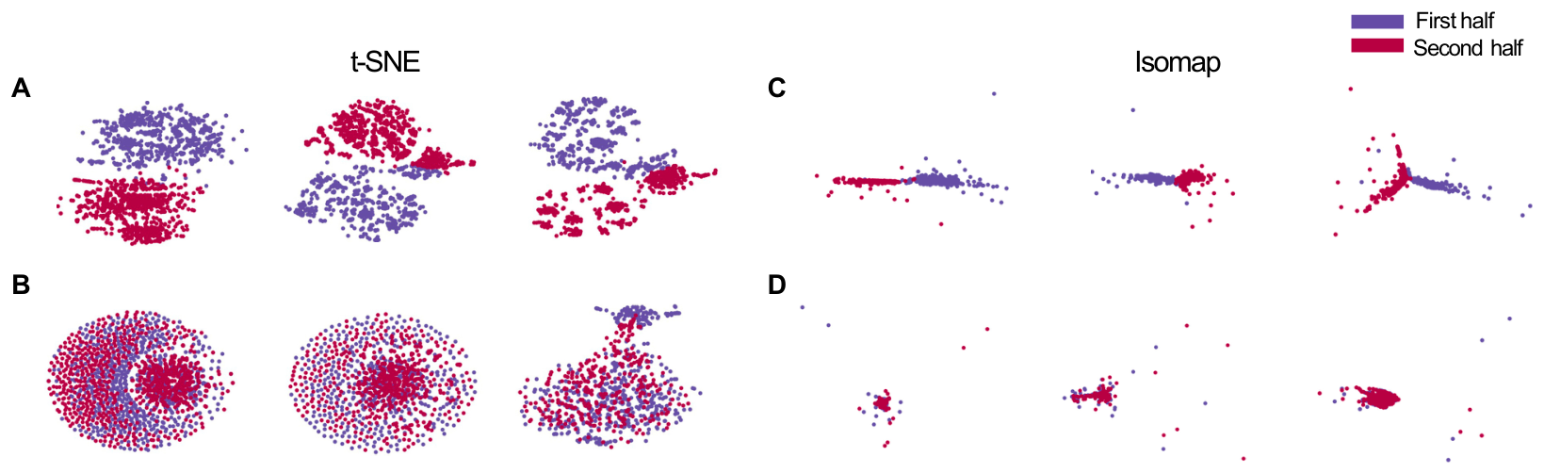
Embeddings distinguish early and late gameplay
Dimensionality reduction represents complex activity with fewer coordinates while retaining selected relationships among observations. The study applied t-SNE and Isomap to neural recordings, using two different algorithms to examine the organization of population activity during rest and gameplay.
Early and late gameplay observations separated in the reduced-dimensional representations, whereas corresponding rest observations overlapped more strongly. The result connects time in the interactive task to changes in the structure of recorded activity. It extends the analysis beyond a single population-average firing rate.
An embedding is the resulting coordinate representation. Its distances reflect the relationships emphasized by the chosen algorithm. Agreement between the two representations supported the distinction between evolving task activity and comparatively stable rest activity, linking changes in population state to the period in which adaptive gameplay occurred.
Khajehnejad et al. (2025), Fig. 3A–D. Reduced-dimensional representations of gameplay and rest.
Khajehnejad et al. (2025)
28
Notes:
• Dimensionality reduction represents complex activity with fewer coordinates while retaining selected relationships among observations. The study applied t-SNE and Isomap to neural recordings, using two different algorithms to examine the organization of population activity during rest and gameplay.
• Early and late gameplay observations separated in the reduced-dimensional representations, whereas corresponding rest observations overlapped more strongly. The result connects time in the interactive task to changes in the structure of recorded activity. It extends the analysis beyond a single population-average firing rate.
• An embedding is the resulting coordinate representation. Its distances reflect the relationships emphasized by the chosen algorithm. Agreement between the two representations supported the distinction between evolving task activity and comparatively stable rest activity, linking changes in population state to the period in which adaptive gameplay occurred.
References:
Khajehnejad M; Habibollahi F; Loeffler A; Paul A; Razi A; Kagan BJ (2025). Dynamic Network Plasticity and Sample Efficiency in Biological Neural Cultures: A Comparative Study with Deep Reinforcement Learning. Cyborg and Bionic Systems 6:0336. https://doi.org/10.34133/cbsystems.0336
Figure: Khajehnejad et al. (2025), Fig. 3A–D. Reduced-dimensional representations of gameplay and rest.
Figure source: https://doi.org/10.34133/cbsystems.0336

Slide 29
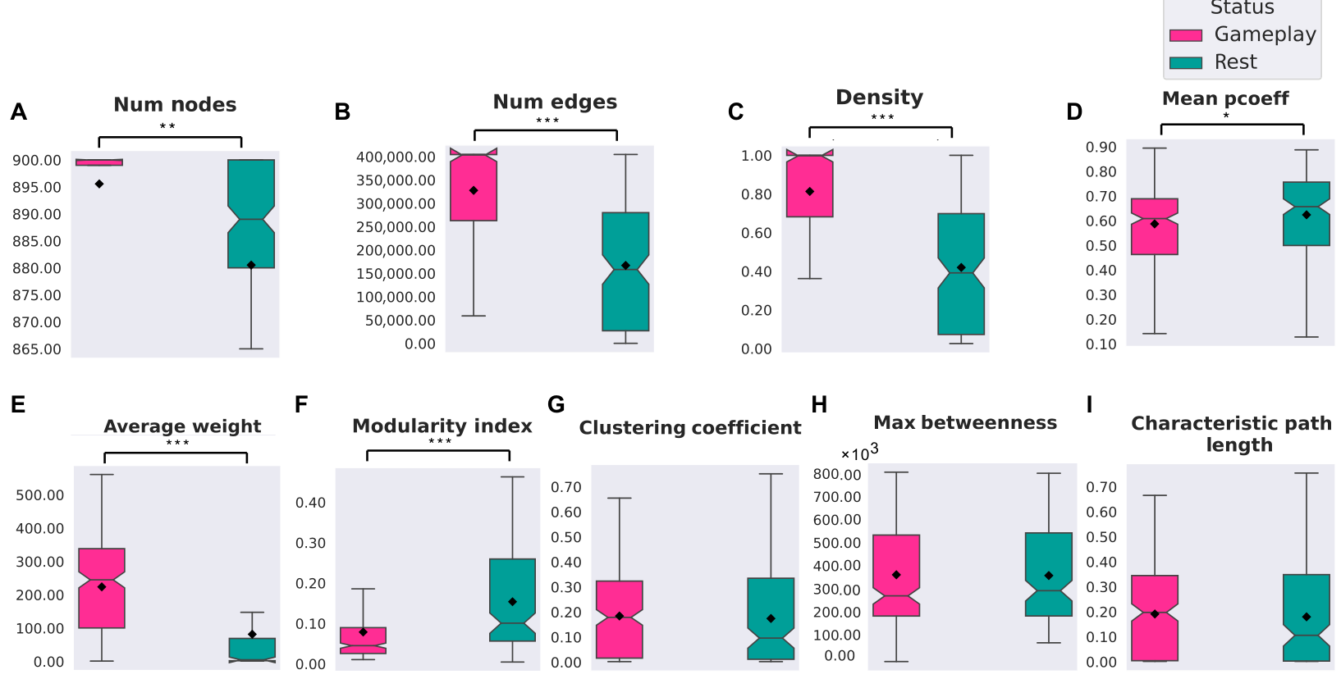
Graphs describe population organization
A network graph represents recording sites as nodes and inferred activity relationships as edges. The study constructed graphs from high-density recordings and compared summary properties during rest and gameplay. These properties described how links were distributed across the recorded population.
Density is the fraction of possible links retained in the graph. Clustering describes the tendency for connected nodes to participate in locally interconnected groups. Both measures relate population coordination to the structure of the inferred network rather than to the number of spikes alone.
Gameplay and rest differed in these summary properties, including stronger inferred connectivity during gameplay. The graph measurements connect the local activity sampled by electrodes with a description of network-wide organization. They complement behavioral measures by characterizing the pattern of population interactions expressed under each environmental condition.
Khajehnejad et al. (2025), Fig. 2A–I. Network summary measures during rest and gameplay.
Khajehnejad et al. (2025)
29
Notes:
• A network graph represents recording sites as nodes and inferred activity relationships as edges. The study constructed graphs from high-density recordings and compared summary properties during rest and gameplay. These properties described how links were distributed across the recorded population.
• Density is the fraction of possible links retained in the graph. Clustering describes the tendency for connected nodes to participate in locally interconnected groups. Both measures relate population coordination to the structure of the inferred network rather than to the number of spikes alone.
• Gameplay and rest differed in these summary properties, including stronger inferred connectivity during gameplay. The graph measurements connect the local activity sampled by electrodes with a description of network-wide organization. They complement behavioral measures by characterizing the pattern of population interactions expressed under each environmental condition.
References:
Khajehnejad M; Habibollahi F; Loeffler A; Paul A; Razi A; Kagan BJ (2025). Dynamic Network Plasticity and Sample Efficiency in Biological Neural Cultures: A Comparative Study with Deep Reinforcement Learning. Cyborg and Bionic Systems 6:0336. https://doi.org/10.34133/cbsystems.0336
Figure: Khajehnejad et al. (2025), Fig. 2A–I. Network summary measures during rest and gameplay.
Figure source: https://doi.org/10.34133/cbsystems.0336

Slide 30
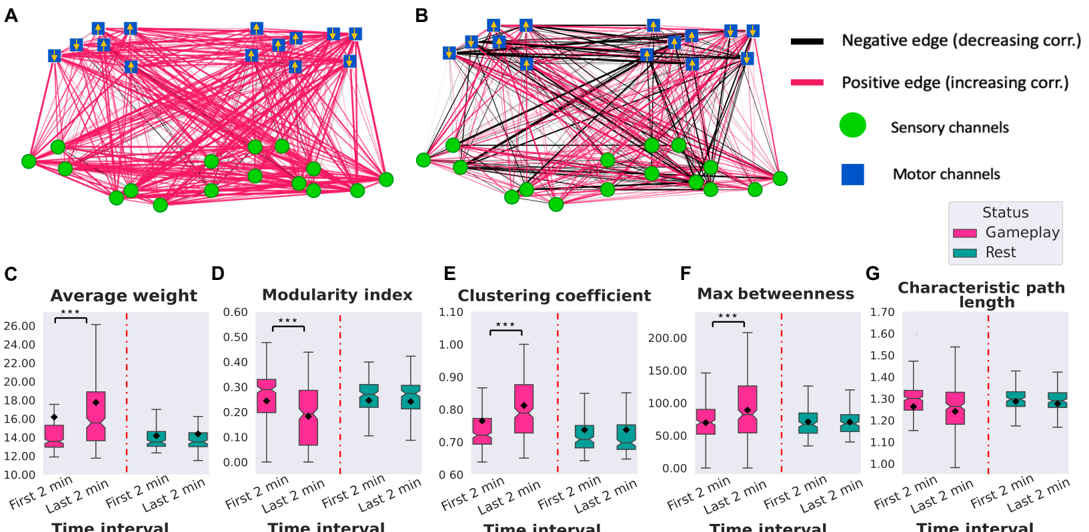
Task-associated links reorganize over time
Khajehnejad and colleagues divided recordings into intervals and examined the evolution of inferred connectivity. Their reduced network retained representative recording channels selected from the larger array, allowing relationships among populations to be compared across time in a consistent arrangement.
During gameplay, average connection weight and local clustering increased, while modularity decreased. Characteristic path length was comparatively stable. Modularity measures separation into relatively strongly connected groups. Path length describes the number of graph links required to connect nodes through the inferred network.
These changes describe a more integrated pattern of recorded activity during interaction. Reduced modular separation accompanied stronger local relationships, without a corresponding reliable change in path length. The measures supply different aspects of population organization, connecting adaptive task engagement with changes in how the culture's activity was coordinated across recording sites.
Khajehnejad et al. (2025), Fig. 4A–G. Network properties across successive recording intervals.
Khajehnejad et al. (2025)
30
Notes:
• Khajehnejad and colleagues divided recordings into intervals and examined the evolution of inferred connectivity. Their reduced network retained representative recording channels selected from the larger array, allowing relationships among populations to be compared across time in a consistent arrangement.
• During gameplay, average connection weight and local clustering increased, while modularity decreased. Characteristic path length was comparatively stable. Modularity measures separation into relatively strongly connected groups. Path length describes the number of graph links required to connect nodes through the inferred network.
• These changes describe a more integrated pattern of recorded activity during interaction. Reduced modular separation accompanied stronger local relationships, without a corresponding reliable change in path length. The measures supply different aspects of population organization, connecting adaptive task engagement with changes in how the culture's activity was coordinated across recording sites.
References:
Khajehnejad M; Habibollahi F; Loeffler A; Paul A; Razi A; Kagan BJ (2025). Dynamic Network Plasticity and Sample Efficiency in Biological Neural Cultures: A Comparative Study with Deep Reinforcement Learning. Cyborg and Bionic Systems 6:0336. https://doi.org/10.34133/cbsystems.0336
Figure: Khajehnejad et al. (2025), Fig. 4A–G. Network properties across successive recording intervals.
Figure source: https://doi.org/10.34133/cbsystems.0336

Slide 31
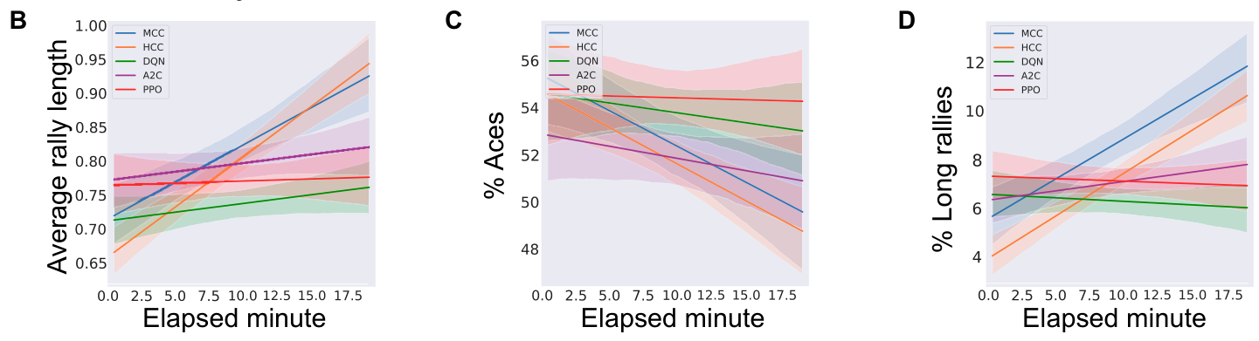
Comparisons match limited training experience
Reinforcement learning adjusts an artificial controller through the consequences of its actions. Khajehnejad and colleagues compared the biological Pong system with Deep Q Network, Advantage Actor-Critic, and Proximal Policy Optimization algorithms. These algorithms use different procedures to improve action selection from experience.
The comparison limited training to 70 episodes, approximating the experience available during a 20-min biological gameplay session. Sample efficiency describes how much experience is required to improve performance. The experiment therefore tested learning under a restricted experience budget rather than unrestricted eventual performance.
With image-based input, the biological cultures achieved more successful returns and fewer immediate failures than the tested artificial controllers. This result connects performance to the training regime: a controller that learns well after extensive training may perform differently when its available experience is constrained to the experiment's short interaction period.
Khajehnejad et al. (2025), Fig. 5B–D. Performance trajectories with image-based algorithm input.
Khajehnejad et al. (2025)
31
Notes:
• Reinforcement learning adjusts an artificial controller through the consequences of its actions. Khajehnejad and colleagues compared the biological Pong system with Deep Q Network, Advantage Actor-Critic, and Proximal Policy Optimization algorithms. These algorithms use different procedures to improve action selection from experience.
• The comparison limited training to 70 episodes, approximating the experience available during a 20-min biological gameplay session. Sample efficiency describes how much experience is required to improve performance. The experiment therefore tested learning under a restricted experience budget rather than unrestricted eventual performance.
• With image-based input, the biological cultures achieved more successful returns and fewer immediate failures than the tested artificial controllers. This result connects performance to the training regime: a controller that learns well after extensive training may perform differently when its available experience is constrained to the experiment's short interaction period.
References:
Khajehnejad M; Habibollahi F; Loeffler A; Paul A; Razi A; Kagan BJ (2025). Dynamic Network Plasticity and Sample Efficiency in Biological Neural Cultures: A Comparative Study with Deep Reinforcement Learning. Cyborg and Bionic Systems 6:0336. https://doi.org/10.34133/cbsystems.0336
Figure: Khajehnejad et al. (2025), Fig. 5B–D. Performance trajectories with image-based algorithm input.
Figure source: https://doi.org/10.34133/cbsystems.0336

Slide 32
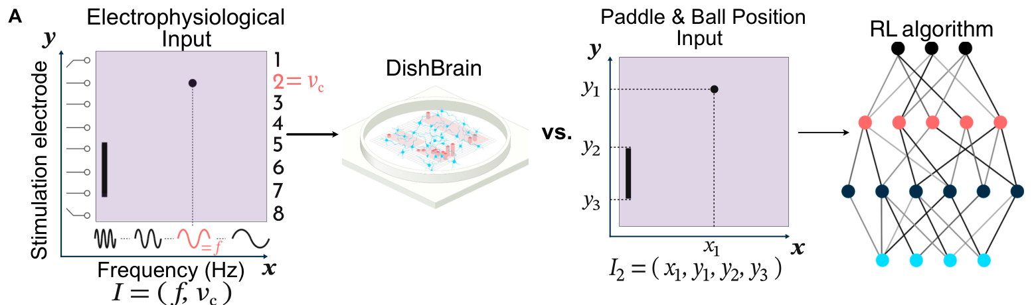
Input representation changes the artificial task
The comparison examined three artificial input designs: a pixel image, numerical paddle-and-ball positions, and ball position alone. Input representation specifies which environmental variables enter a controller and how they are expressed. Changing it alters the information available for selecting an action.
The numerical paddle-and-ball design supplied explicit coordinates, reducing the burden of extracting position from an image. The biological controller instead received electrical stimulation encoding ball position and approach. These interfaces provided related task information through different physical and computational forms.
Testing several input designs addressed whether the artificial controllers' performance depended on high-dimensional image processing. The comparison connected algorithm performance to the variables entering the system, rather than assigning learning efficiency solely from one sensory representation. Environmental information and action rules remain part of the experimental definition of each controller.
Khajehnejad et al. (2025), Fig. 6A. Biological input and numerical paddle-and-ball input.
Khajehnejad et al. (2025)
32
Notes:
• The comparison examined three artificial input designs: a pixel image, numerical paddle-and-ball positions, and ball position alone. Input representation specifies which environmental variables enter a controller and how they are expressed. Changing it alters the information available for selecting an action.
• The numerical paddle-and-ball design supplied explicit coordinates, reducing the burden of extracting position from an image. The biological controller instead received electrical stimulation encoding ball position and approach. These interfaces provided related task information through different physical and computational forms.
• Testing several input designs addressed whether the artificial controllers' performance depended on high-dimensional image processing. The comparison connected algorithm performance to the variables entering the system, rather than assigning learning efficiency solely from one sensory representation. Environmental information and action rules remain part of the experimental definition of each controller.
References:
Khajehnejad M; Habibollahi F; Loeffler A; Paul A; Razi A; Kagan BJ (2025). Dynamic Network Plasticity and Sample Efficiency in Biological Neural Cultures: A Comparative Study with Deep Reinforcement Learning. Cyborg and Bionic Systems 6:0336. https://doi.org/10.34133/cbsystems.0336
Figure: Khajehnejad et al. (2025), Fig. 6A. Biological input and numerical paddle-and-ball input.
Figure source: https://doi.org/10.34133/cbsystems.0336

Slide 33
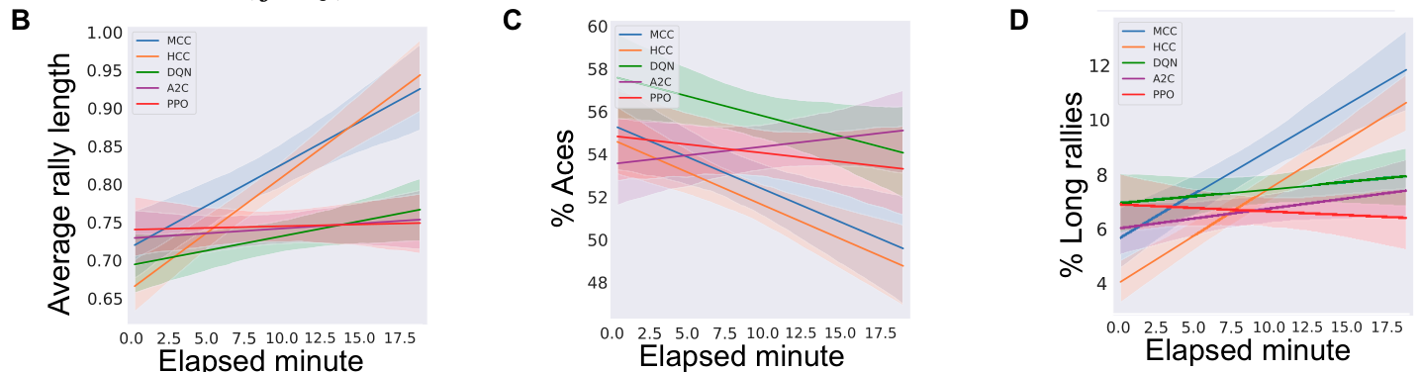
Performance gains persist across input designs
The numerical-input comparisons retained the same limited training budget while altering the information delivered to the artificial controllers. This manipulation separated the cost of image interpretation from the controller's ability to learn a useful action policy through experience.
Biological cultures increased average rally length and reduced immediate failures across the tested comparison designs. Artificial controller outcomes varied with algorithm and input representation. Providing more direct environmental coordinates changed particular measures without reproducing the full biological pattern of improvement within the available experience.
A policy is a rule for selecting actions from the available state information. The observed results concern policies acquired under these specific encoding, reward, and training conditions. They connect sample efficiency to the complete task arrangement, including which state variables are provided and how experience updates the controller.
Khajehnejad et al. (2025), Fig. 6B–D. Performance with numerical paddle-and-ball input.
Khajehnejad et al. (2025)
33
Notes:
• The numerical-input comparisons retained the same limited training budget while altering the information delivered to the artificial controllers. This manipulation separated the cost of image interpretation from the controller's ability to learn a useful action policy through experience.
• Biological cultures increased average rally length and reduced immediate failures across the tested comparison designs. Artificial controller outcomes varied with algorithm and input representation. Providing more direct environmental coordinates changed particular measures without reproducing the full biological pattern of improvement within the available experience.
• A policy is a rule for selecting actions from the available state information. The observed results concern policies acquired under these specific encoding, reward, and training conditions. They connect sample efficiency to the complete task arrangement, including which state variables are provided and how experience updates the controller.
References:
Khajehnejad M; Habibollahi F; Loeffler A; Paul A; Razi A; Kagan BJ (2025). Dynamic Network Plasticity and Sample Efficiency in Biological Neural Cultures: A Comparative Study with Deep Reinforcement Learning. Cyborg and Bionic Systems 6:0336. https://doi.org/10.34133/cbsystems.0336
Figure: Khajehnejad et al. (2025), Fig. 6B–D. Performance with numerical paddle-and-ball input.
Figure source: https://doi.org/10.34133/cbsystems.0336

Slide 34
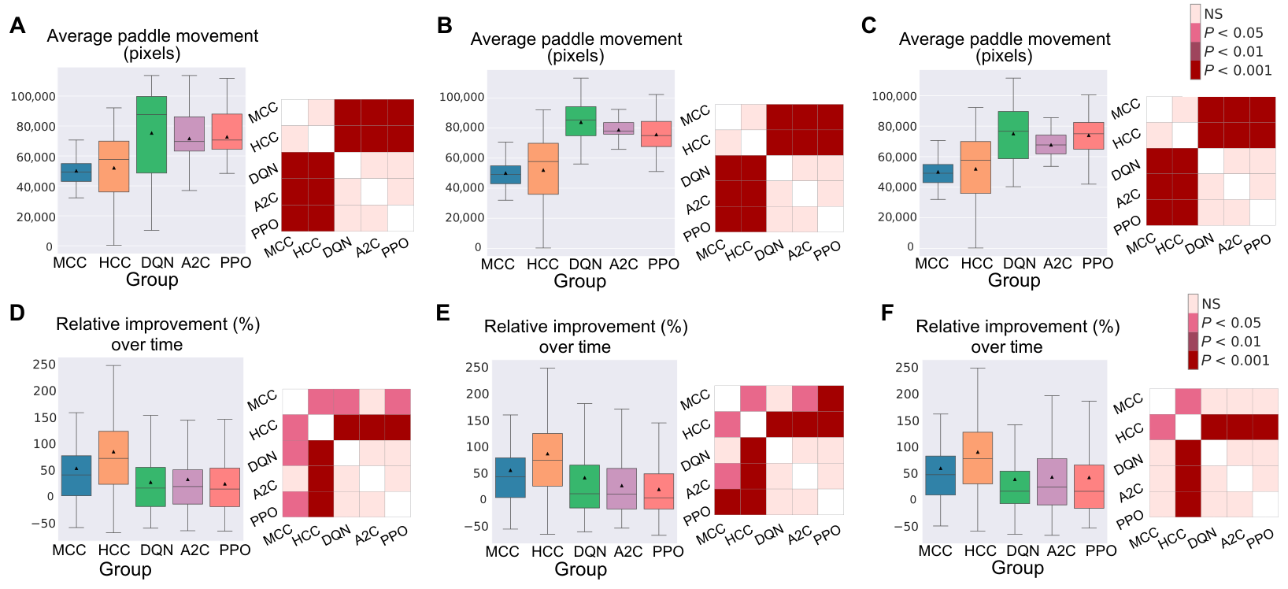
Movement and success are different measures
An artificial controller can move the paddle frequently without sustaining successful returns. The study measured total paddle movement alongside changes in performance, separating the amount of output from the quality of sensorimotor coordination during the game.
The artificial algorithms produced greater paddle movement than the biological cultures in the comparisons, yet greater movement did not translate into greater improvement. Biological systems improved the relationship between input and action while producing less total displacement under the tested conditions.
The distinction concerns task-directed output, activity organized to meet an environmental requirement. Paddle displacement measures how much action occurs; rally length measures whether successive actions intercept the ball. Their different outcomes connect adaptive performance with the timing and direction of output rather than with the volume of commands issued by a controller.
Khajehnejad et al. (2025), Fig. 8A–F. Paddle movement and change in task performance.
Khajehnejad et al. (2025)
34
Notes:
• An artificial controller can move the paddle frequently without sustaining successful returns. The study measured total paddle movement alongside changes in performance, separating the amount of output from the quality of sensorimotor coordination during the game.
• The artificial algorithms produced greater paddle movement than the biological cultures in the comparisons, yet greater movement did not translate into greater improvement. Biological systems improved the relationship between input and action while producing less total displacement under the tested conditions.
• The distinction concerns task-directed output, activity organized to meet an environmental requirement. Paddle displacement measures how much action occurs; rally length measures whether successive actions intercept the ball. Their different outcomes connect adaptive performance with the timing and direction of output rather than with the volume of commands issued by a controller.
References:
Khajehnejad M; Habibollahi F; Loeffler A; Paul A; Razi A; Kagan BJ (2025). Dynamic Network Plasticity and Sample Efficiency in Biological Neural Cultures: A Comparative Study with Deep Reinforcement Learning. Cyborg and Bionic Systems 6:0336. https://doi.org/10.34133/cbsystems.0336
Figure: Khajehnejad et al. (2025), Fig. 8A–F. Paddle movement and change in task performance.
Figure source: https://doi.org/10.34133/cbsystems.0336

Slide 35
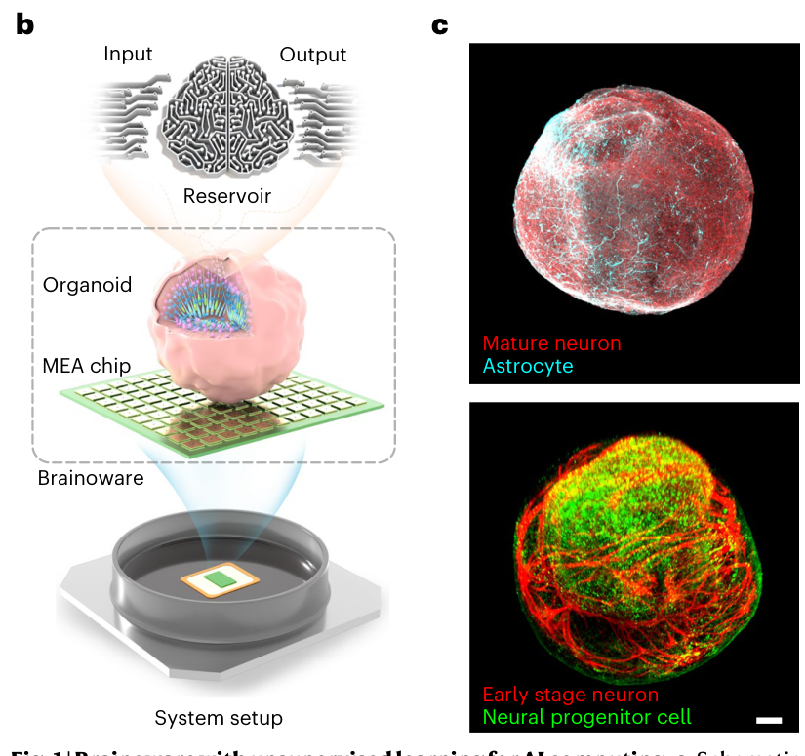
An organoid acts as an adaptive reservoir
A reservoir transforms a time-varying input into a rich pattern of internal states that a simpler readout can use. Cai and colleagues mounted a human brain organoid on a high-density electrode array, using living neural activity as the physical reservoir in Brainoware.
A brain organoid is a three-dimensional tissue aggregate developed from pluripotent cells through differentiation and self-organization. Immunostaining identified neurons, neural progenitor cells, and astrocytes in the preparation. Electrical stimulation entered the tissue through the array, and evoked activity supplied the output features.
The electronic readout mapped these features onto a computational answer. Unlike the Pong paddle loop, this arrangement separated tissue responses from a trained classification or prediction function. The biological reservoir transformed input, while the readout supplied the task-specific mapping from measured neural activity to the desired output.
Cai et al. (2023), Fig. 1B–C. Organoid-electrode arrangement and neuronal tissue markers.
Cai et al. (2023)
35
Notes:
• A reservoir transforms a time-varying input into a rich pattern of internal states that a simpler readout can use. Cai and colleagues mounted a human brain organoid on a high-density electrode array, using living neural activity as the physical reservoir in Brainoware.
• A brain organoid is a three-dimensional tissue aggregate developed from pluripotent cells through differentiation and self-organization. Immunostaining identified neurons, neural progenitor cells, and astrocytes in the preparation. Electrical stimulation entered the tissue through the array, and evoked activity supplied the output features.
• The electronic readout mapped these features onto a computational answer. Unlike the Pong paddle loop, this arrangement separated tissue responses from a trained classification or prediction function. The biological reservoir transformed input, while the readout supplied the task-specific mapping from measured neural activity to the desired output.
References:
Cai H; Ao Z; Tian C; Wu Z; Liu H; Tchieu J; Gu M; Mackie K; Guo F (2023). Brain organoid reservoir computing for artificial intelligence. Nature Electronics 6(12):1032–1039. https://doi.org/10.1038/s41928-023-01069-w
Figure: Cai et al. (2023), Fig. 1B–C. Organoid-electrode arrangement and neuronal tissue markers.
Figure source: https://doi.org/10.1038/s41928-023-01069-w

Slide 36
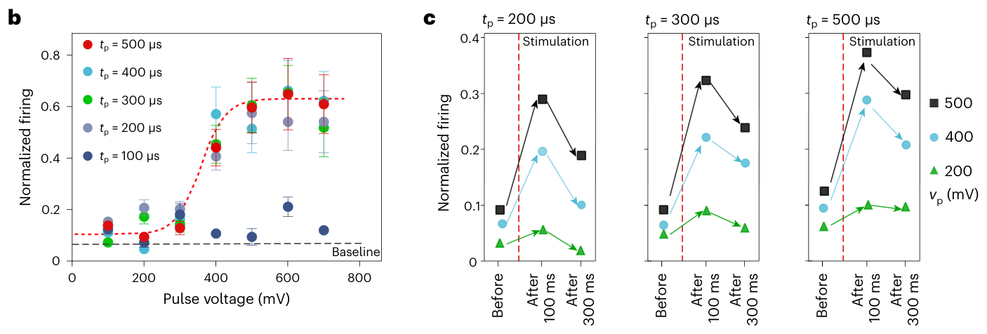
Pulse parameters produce nonlinear responses
Nonlinearity means that the output is not simply proportional to the input. Cai and colleagues varied the voltage and duration of bipolar electrical pulses delivered to an organoid. With pulse durations of at least 200 µs, evoked firing varied sigmoidally with stimulus voltage.
A sigmoid response rises slowly at low input, more strongly across an intermediate range, and then approaches a plateau. Shorter 100-µs pulses produced responses near the spontaneous baseline in the tested organoid. Input duration therefore affected whether voltage changes recruited substantial network activity.
The same preparation expressed fading responses after stimulation. Pulse voltage and duration altered both response strength and persistence. These properties allow a physical reservoir to transform inputs into nonlinear, history-dependent activity, giving the readout more than a direct copy of the applied electrical stimulus.
Cai et al. (2023), Fig. 2B–C. Voltage dependence and fading of evoked responses.
Cai et al. (2023)
36
Notes:
• Nonlinearity means that the output is not simply proportional to the input. Cai and colleagues varied the voltage and duration of bipolar electrical pulses delivered to an organoid. With pulse durations of at least 200 µs, evoked firing varied sigmoidally with stimulus voltage.
• A sigmoid response rises slowly at low input, more strongly across an intermediate range, and then approaches a plateau. Shorter 100-µs pulses produced responses near the spontaneous baseline in the tested organoid. Input duration therefore affected whether voltage changes recruited substantial network activity.
• The same preparation expressed fading responses after stimulation. Pulse voltage and duration altered both response strength and persistence. These properties allow a physical reservoir to transform inputs into nonlinear, history-dependent activity, giving the readout more than a direct copy of the applied electrical stimulus.
References:
Cai H; Ao Z; Tian C; Wu Z; Liu H; Tchieu J; Gu M; Mackie K; Guo F (2023). Brain organoid reservoir computing for artificial intelligence. Nature Electronics 6(12):1032–1039. https://doi.org/10.1038/s41928-023-01069-w
Figure: Cai et al. (2023), Fig. 2B–C. Voltage dependence and fading of evoked responses.
Figure source: https://doi.org/10.1038/s41928-023-01069-w

Slide 37
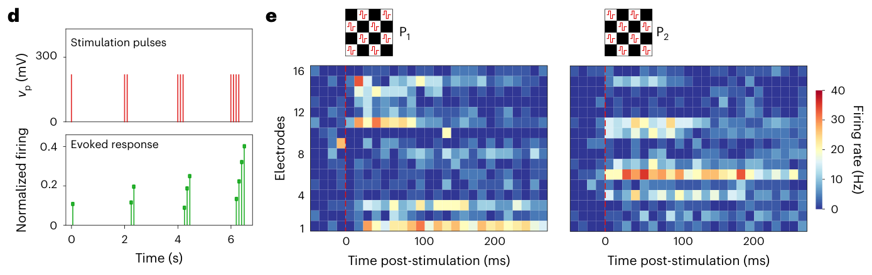
Fading activity retains a short input history
Fading memory is a temporary dependence of a system's present state on earlier inputs. Brainoware responses persisted after a pulse and decayed over time. The investigators compared activity before stimulation and at 100 and 300 ms after its end.
Pulse trains with 50-ms intervals produced accumulating responses followed by relaxation. A subsequent pulse therefore entered a network whose activity still depended on earlier stimulation. The input sequence, rather than only the current pulse, influenced the resulting output.
Complementary spatial stimulation patterns also produced distinct activity distributions across recording sites. Temporal persistence and spatial differentiation jointly supplied the reservoir with information about input history and input location. The readout could use this distributed activity to classify or predict temporally structured data encoded through the electrode interface.
Cai et al. (2023), Fig. 2D–E. Accumulating responses and spatially distinct input patterns.
Cai et al. (2023)
37
Notes:
• Fading memory is a temporary dependence of a system's present state on earlier inputs. Brainoware responses persisted after a pulse and decayed over time. The investigators compared activity before stimulation and at 100 and 300 ms after its end.
• Pulse trains with 50-ms intervals produced accumulating responses followed by relaxation. A subsequent pulse therefore entered a network whose activity still depended on earlier stimulation. The input sequence, rather than only the current pulse, influenced the resulting output.
• Complementary spatial stimulation patterns also produced distinct activity distributions across recording sites. Temporal persistence and spatial differentiation jointly supplied the reservoir with information about input history and input location. The readout could use this distributed activity to classify or predict temporally structured data encoded through the electrode interface.
References:
Cai H; Ao Z; Tian C; Wu Z; Liu H; Tchieu J; Gu M; Mackie K; Guo F (2023). Brain organoid reservoir computing for artificial intelligence. Nature Electronics 6(12):1032–1039. https://doi.org/10.1038/s41928-023-01069-w
Figure: Cai et al. (2023), Fig. 2D–E. Accumulating responses and spatially distinct input patterns.
Figure source: https://doi.org/10.1038/s41928-023-01069-w

Slide 38
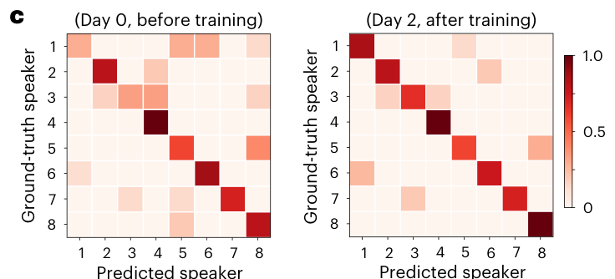
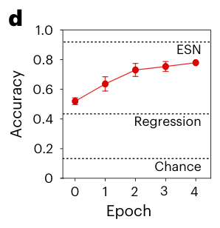
Speech classification uses a trained readout
Brainoware classified speakers from isolated Japanese vowel recordings. The task used /a/ and /e/ utterances from eight male speakers, converted into spatiotemporal electrical stimulation. Classification assigns an input to a category, here the identity of the speaker who produced the recording.
Evoked organoid activity entered a logistic-regression readout, an algorithm trained to map response features onto speaker labels. Training also repeatedly exposed the organoid to the encoded recordings. The experiment therefore included supervised readout fitting alongside repeated stimulation of an adaptive biological reservoir.
Classification accuracy increased from about 51% before training to about 78% after four epochs over two days. An epoch is one presentation of the training dataset. The behavioral analog is recognition of a category from structured input, implemented jointly by the tissue's response transformation and the electronically trained output mapping.
Cai et al. (2023), Fig. 3C. Speaker classification before and after training.
Cai et al. (2023), Fig. 3D. Classification accuracy across training epochs.
Cai et al. (2023)
38
Notes:
• Brainoware classified speakers from isolated Japanese vowel recordings. The task used /a/ and /e/ utterances from eight male speakers, converted into spatiotemporal electrical stimulation. Classification assigns an input to a category, here the identity of the speaker who produced the recording.
• Evoked organoid activity entered a logistic-regression readout, an algorithm trained to map response features onto speaker labels. Training also repeatedly exposed the organoid to the encoded recordings. The experiment therefore included supervised readout fitting alongside repeated stimulation of an adaptive biological reservoir.
• Classification accuracy increased from about 51% before training to about 78% after four epochs over two days. An epoch is one presentation of the training dataset. The behavioral analog is recognition of a category from structured input, implemented jointly by the tissue's response transformation and the electronically trained output mapping.
References:
Cai H; Ao Z; Tian C; Wu Z; Liu H; Tchieu J; Gu M; Mackie K; Guo F (2023). Brain organoid reservoir computing for artificial intelligence. Nature Electronics 6(12):1032–1039. https://doi.org/10.1038/s41928-023-01069-w
Figure: Cai et al. (2023), Fig. 3C. Speaker classification before and after training.
Figure source: https://doi.org/10.1038/s41928-023-01069-w
Figure: Cai et al. (2023), Fig. 3D. Classification accuracy across training epochs.
Figure source: https://doi.org/10.1038/s41928-023-01069-w

Slide 39
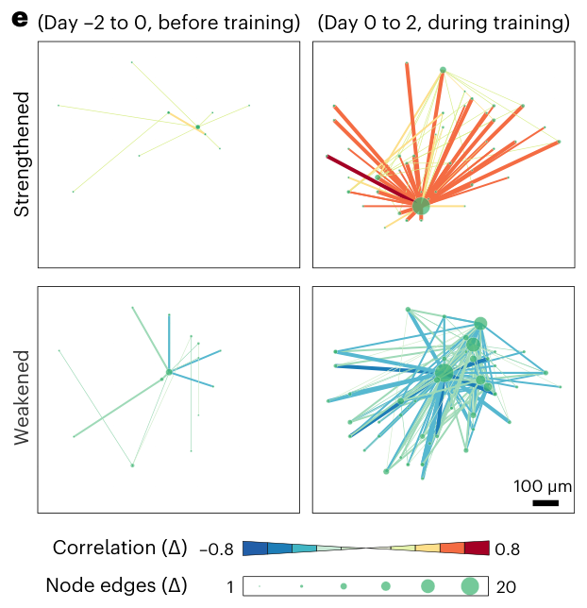
Training changes organoid activity relationships
Repeated presentation of the speech dataset changed inferred functional connectivity in the organoid. Cai and colleagues compared spontaneous activity before training with activity recorded during the training period, identifying relationships that strengthened, weakened, appeared, or were pruned.
The analysis linked the improvement in classification to a changing biological reservoir. A fixed physical reservoir would leave its internal transformation unchanged while only the readout learned. Brainoware instead combined readout fitting with tissue whose recorded activity relationships evolved during repeated input.
Unsupervised reservoir adaptation refers to changes in the tissue without direct label-based adjustment of its individual connections. Speaker labels trained the electronic classifier, while repeated electrical input changed the organoid's response organization. Separating these processes explains how supervised output training and biological adaptation contributed different components of the complete computation.
Cai et al. (2023), Fig. 3E. Functional-connectivity changes during repeated speech inputs.
Cai et al. (2023)
39
Notes:
• Repeated presentation of the speech dataset changed inferred functional connectivity in the organoid. Cai and colleagues compared spontaneous activity before training with activity recorded during the training period, identifying relationships that strengthened, weakened, appeared, or were pruned.
• The analysis linked the improvement in classification to a changing biological reservoir. A fixed physical reservoir would leave its internal transformation unchanged while only the readout learned. Brainoware instead combined readout fitting with tissue whose recorded activity relationships evolved during repeated input.
• Unsupervised reservoir adaptation refers to changes in the tissue without direct label-based adjustment of its individual connections. Speaker labels trained the electronic classifier, while repeated electrical input changed the organoid's response organization. Separating these processes explains how supervised output training and biological adaptation contributed different components of the complete computation.
References:
Cai H; Ao Z; Tian C; Wu Z; Liu H; Tchieu J; Gu M; Mackie K; Guo F (2023). Brain organoid reservoir computing for artificial intelligence. Nature Electronics 6(12):1032–1039. https://doi.org/10.1038/s41928-023-01069-w
Figure: Cai et al. (2023), Fig. 3E. Functional-connectivity changes during repeated speech inputs.
Figure source: https://doi.org/10.1038/s41928-023-01069-w

Slide 40
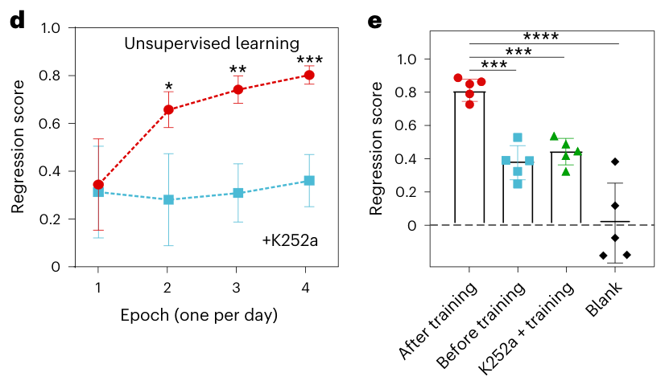
Prediction combines tissue and readout
A time-series prediction estimates a later value from earlier values. Cai and colleagues encoded a Hénon-map sequence, a mathematical system producing chaotic dynamics, into electrical inputs and trained a linear readout to predict the next value from organoid responses.
Prediction improved over four daily training epochs. Organoids exposed to K252a, which the study used to interfere with activity-dependent plasticity, showed much less improvement under the same training procedure. A blank condition without the organoid supplied another comparison for the contribution of the living reservoir.
The pharmacological result links adaptation to biological activity-dependent processes. The tissue transformed the encoded sequence, and the readout converted that transformation into a prediction. Better prediction therefore arose from the interaction between the adaptive reservoir and output mapping, a computational arrangement distinct from action-contingent feedback in Pong.
Cai et al. (2023), Fig. 4D–E. Prediction improvement and plasticity-blocker comparison.
Cai et al. (2023)
40
Notes:
• A time-series prediction estimates a later value from earlier values. Cai and colleagues encoded a Hénon-map sequence, a mathematical system producing chaotic dynamics, into electrical inputs and trained a linear readout to predict the next value from organoid responses.
• Prediction improved over four daily training epochs. Organoids exposed to K252a, which the study used to interfere with activity-dependent plasticity, showed much less improvement under the same training procedure. A blank condition without the organoid supplied another comparison for the contribution of the living reservoir.
• The pharmacological result links adaptation to biological activity-dependent processes. The tissue transformed the encoded sequence, and the readout converted that transformation into a prediction. Better prediction therefore arose from the interaction between the adaptive reservoir and output mapping, a computational arrangement distinct from action-contingent feedback in Pong.
References:
Cai H; Ao Z; Tian C; Wu Z; Liu H; Tchieu J; Gu M; Mackie K; Guo F (2023). Brain organoid reservoir computing for artificial intelligence. Nature Electronics 6(12):1032–1039. https://doi.org/10.1038/s41928-023-01069-w
Figure: Cai et al. (2023), Fig. 4D–E. Prediction improvement and plasticity-blocker comparison.
Figure source: https://doi.org/10.1038/s41928-023-01069-w

Slide 41
Sentience requires a definition of experience
Sentience, in welfare discussions, concerns the capacity for subjective experience, including experiences with positive or negative value. Kagan and colleagues used a narrower operational definition centered on responsiveness to sensory impressions. Milford, Shaw, and Starke examined the ethical consequences of this difference in terminology.
A recorded change in gameplay establishes a change in task performance. A claim about experienced pleasure or suffering requires an account of how that performance relates to subjective states. The ethical analysis distinguishes successful adaptation from phenomenal consciousness, the presence of something it is like to undergo an experience.
This distinction changes welfare conclusions. Performance measurements characterize the culture-interface system's behavior, while a morally relevant experience would supply a different reason for protection. Clear definitions connect the measurement being made to the claim being considered, preventing an operational use of sentience from silently becoming a claim of experienced suffering.
Milford et al. (2023); Kagan et al. (2022)
41
Notes:
• Sentience, in welfare discussions, concerns the capacity for subjective experience, including experiences with positive or negative value. Kagan and colleagues used a narrower operational definition centered on responsiveness to sensory impressions. Milford, Shaw, and Starke examined the ethical consequences of this difference in terminology.
• A recorded change in gameplay establishes a change in task performance. A claim about experienced pleasure or suffering requires an account of how that performance relates to subjective states. The ethical analysis distinguishes successful adaptation from phenomenal consciousness, the presence of something it is like to undergo an experience.
• This distinction changes welfare conclusions. Performance measurements characterize the culture-interface system's behavior, while a morally relevant experience would supply a different reason for protection. Clear definitions connect the measurement being made to the claim being considered, preventing an operational use of sentience from silently becoming a claim of experienced suffering.
References:
Milford SR; Shaw D; Starke G (2023). Playing Brains: The Ethical Challenges Posed by Silicon Sentience and Hybrid Intelligence in DishBrain. Science and Engineering Ethics 29(6):38. https://doi.org/10.1007/s11948-023-00457-x
Kagan BJ; Kitchen AC; Tran NT; Habibollahi F; Khajehnejad M; Parker BJ; Bhat A; Rollo B; Razi A; Friston KJ (2022). In vitro neurons learn and exhibit sentience when embodied in a simulated game-world. Neuron 110(23):3952–3969.e8. https://doi.org/10.1016/j.neuron.2022.09.001

Slide 42
Feedback and experienced valence differ
Valence is the positive or negative quality of an experience. DishBrain's predictable and unpredictable feedback conditions were defined by electrical stimulation schedules and their consequences for gameplay. The experiment measured neural activity and task performance, rather than an experienced emotional value assigned to those schedules.
Milford and colleagues discuss a hypothesis linking prediction error with negative phenomenal valence. A prediction error is a mismatch between an expected input and the input received. Their ethical argument depends on additional assumptions connecting computational mismatch to experience in a sufficiently complex system.
The welfare-relevant distinction is between a consequence that changes behavior and a consequence that is experienced negatively. The authors analyze possible conditions for artificial suffering, including subjective experience, a self-model, and negatively valued states. These are elements of their ethical framework, rather than physiological outcomes measured by the Pong experiment.
Milford et al. (2023); Kagan et al. (2022)
42
Notes:
• Valence is the positive or negative quality of an experience. DishBrain's predictable and unpredictable feedback conditions were defined by electrical stimulation schedules and their consequences for gameplay. The experiment measured neural activity and task performance, rather than an experienced emotional value assigned to those schedules.
• Milford and colleagues discuss a hypothesis linking prediction error with negative phenomenal valence. A prediction error is a mismatch between an expected input and the input received. Their ethical argument depends on additional assumptions connecting computational mismatch to experience in a sufficiently complex system.
• The welfare-relevant distinction is between a consequence that changes behavior and a consequence that is experienced negatively. The authors analyze possible conditions for artificial suffering, including subjective experience, a self-model, and negatively valued states. These are elements of their ethical framework, rather than physiological outcomes measured by the Pong experiment.
References:
Milford SR; Shaw D; Starke G (2023). Playing Brains: The Ethical Challenges Posed by Silicon Sentience and Hybrid Intelligence in DishBrain. Science and Engineering Ethics 29(6):38. https://doi.org/10.1007/s11948-023-00457-x
Kagan BJ; Kitchen AC; Tran NT; Habibollahi F; Khajehnejad M; Parker BJ; Bhat A; Rollo B; Razi A; Friston KJ (2022). In vitro neurons learn and exhibit sentience when embodied in a simulated game-world. Neuron 110(23):3952–3969.e8. https://doi.org/10.1016/j.neuron.2022.09.001

Slide 43
Precaution informs choices under uncertainty
The precautionary principle supports protective action when an uncertain risk could have serious consequences. Milford and colleagues apply it to the possibility that increasingly complex synthetic neural systems could develop morally relevant experiences. Their proposal is an ethical position grounded in a particular account of consciousness.
They recommend limits on the number and types of neurons used, the experimental applications, and research duration while criteria for experience and suffering are developed. They also call for combined philosophical and empirical work on definitions and measurements of consciousness and sentience.
These recommendations concern how research should be governed under uncertainty. They differ from an experimentally established welfare threshold. The connection to neurobiology lies in which properties of a neural preparation are considered relevant to experience, how those properties are assessed, and how experimental design changes in response to the resulting ethical judgment.
Milford et al. (2023)
43
Notes:
• The precautionary principle supports protective action when an uncertain risk could have serious consequences. Milford and colleagues apply it to the possibility that increasingly complex synthetic neural systems could develop morally relevant experiences. Their proposal is an ethical position grounded in a particular account of consciousness.
• They recommend limits on the number and types of neurons used, the experimental applications, and research duration while criteria for experience and suffering are developed. They also call for combined philosophical and empirical work on definitions and measurements of consciousness and sentience.
• These recommendations concern how research should be governed under uncertainty. They differ from an experimentally established welfare threshold. The connection to neurobiology lies in which properties of a neural preparation are considered relevant to experience, how those properties are assessed, and how experimental design changes in response to the resulting ethical judgment.
References:
Milford SR; Shaw D; Starke G (2023). Playing Brains: The Ethical Challenges Posed by Silicon Sentience and Hybrid Intelligence in DishBrain. Science and Engineering Ethics 29(6):38. https://doi.org/10.1007/s11948-023-00457-x

Slide 44
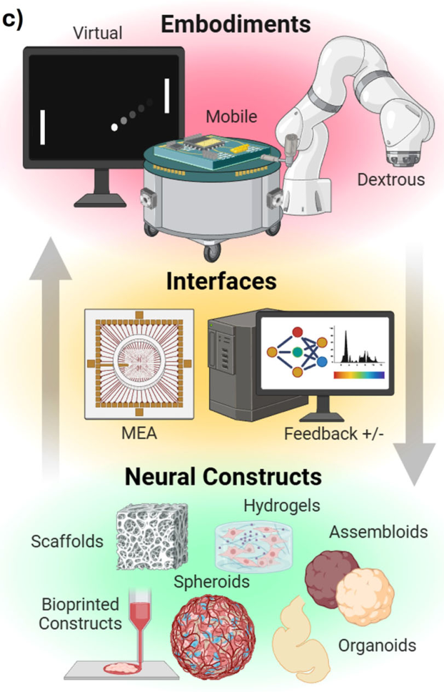
Doom is a reported extension of embodiment
Sellar and Rouleau's 2026 perspective describes virtual embodiment as one route for synthetic biological intelligence. Embodiment here means a causal connection between a neural construct and an environment through input, action, and feedback. Their discussion mentions Doom as a later extension of game interaction.
The cited experimental Pong work supplies documented encoding, decoding, feedback schedules, and performance comparisons. The perspective's Doom mention supplies no corresponding experimental protocol or measured learning trajectory. The available sources therefore support different levels of detail for the two games.
A game connection and adaptive task performance are separate achievements. The former establishes that neural output can affect an environment; the latter requires measured improvement and appropriate controls. The distinction determines whether a claim concerns a functioning interface, a changing action policy, or a demonstrated learning effect under specified conditions.
Sellar & Rouleau (2026), Fig. 1C. Published comparison of virtual and physical embodiments.
Sellar & Rouleau (2026); Kagan et al. (2022)
44
Notes:
• Sellar and Rouleau's 2026 perspective describes virtual embodiment as one route for synthetic biological intelligence. Embodiment here means a causal connection between a neural construct and an environment through input, action, and feedback. Their discussion mentions Doom as a later extension of game interaction.
• The cited experimental Pong work supplies documented encoding, decoding, feedback schedules, and performance comparisons. The perspective's Doom mention supplies no corresponding experimental protocol or measured learning trajectory. The available sources therefore support different levels of detail for the two games.
• A game connection and adaptive task performance are separate achievements. The former establishes that neural output can affect an environment; the latter requires measured improvement and appropriate controls. The distinction determines whether a claim concerns a functioning interface, a changing action policy, or a demonstrated learning effect under specified conditions.
References:
Sellar EP; Rouleau N (2026). A cybernetic framework for synthetic biological intelligence in the era of neural tissue engineering. npj Unconventional Computing 3:31. https://doi.org/10.1038/s44335-026-00077-1
Kagan BJ; Kitchen AC; Tran NT; Habibollahi F; Khajehnejad M; Parker BJ; Bhat A; Rollo B; Razi A; Friston KJ (2022). In vitro neurons learn and exhibit sentience when embodied in a simulated game-world. Neuron 110(23):3952–3969.e8. https://doi.org/10.1016/j.neuron.2022.09.001
Figure: Sellar & Rouleau (2026), Fig. 1C. Published comparison of virtual and physical embodiments.
Figure source: https://doi.org/10.1038/s44335-026-00077-1

Slide 45
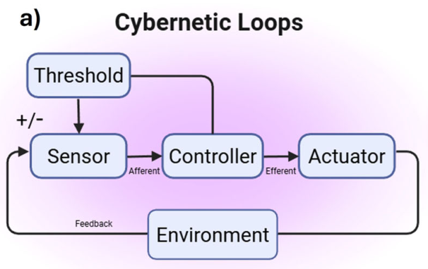
The interface defines sensing and action
Cybernetics studies control and communication in systems that link sensing, action, and feedback. Sellar and Rouleau describe controllers whose outputs alter the environment and thereby change subsequent input. The functional loop can include both living neural tissue and electronic components.
Pong supplied a small action space, upward or downward paddle movement, and electrically encoded ball information. Brainoware supplied classification and prediction readouts. These systems assigned different meanings to neural output because their interfaces implemented different computational tasks and different relationships between input and consequence.
Adaptive behavior is consequently a property of the coupled arrangement. Encoding determines accessible information, decoding determines available output, and feedback determines the consequences returned to the network. Evaluating performance or welfare requires specifying those relationships alongside the neural preparation, because changing the interface changes what the same tissue can sense and control.
Sellar & Rouleau (2026), Fig. 1A. Published sensor-controller-actuator feedback loop.
Sellar & Rouleau (2026); Kagan et al. (2022); Cai et al. (2023)
45
Notes:
• Cybernetics studies control and communication in systems that link sensing, action, and feedback. Sellar and Rouleau describe controllers whose outputs alter the environment and thereby change subsequent input. The functional loop can include both living neural tissue and electronic components.
• Pong supplied a small action space, upward or downward paddle movement, and electrically encoded ball information. Brainoware supplied classification and prediction readouts. These systems assigned different meanings to neural output because their interfaces implemented different computational tasks and different relationships between input and consequence.
• Adaptive behavior is consequently a property of the coupled arrangement. Encoding determines accessible information, decoding determines available output, and feedback determines the consequences returned to the network. Evaluating performance or welfare requires specifying those relationships alongside the neural preparation, because changing the interface changes what the same tissue can sense and control.
References:
Sellar EP; Rouleau N (2026). A cybernetic framework for synthetic biological intelligence in the era of neural tissue engineering. npj Unconventional Computing 3:31. https://doi.org/10.1038/s44335-026-00077-1
Kagan BJ; Kitchen AC; Tran NT; Habibollahi F; Khajehnejad M; Parker BJ; Bhat A; Rollo B; Razi A; Friston KJ (2022). In vitro neurons learn and exhibit sentience when embodied in a simulated game-world. Neuron 110(23):3952–3969.e8. https://doi.org/10.1016/j.neuron.2022.09.001
Cai H; Ao Z; Tian C; Wu Z; Liu H; Tchieu J; Gu M; Mackie K; Guo F (2023). Brain organoid reservoir computing for artificial intelligence. Nature Electronics 6(12):1032–1039. https://doi.org/10.1038/s41928-023-01069-w
Figure: Sellar & Rouleau (2026), Fig. 1A. Published sensor-controller-actuator feedback loop.
Figure source: https://doi.org/10.1038/s44335-026-00077-1

Slide 46
Key takeaways
Contingent feedback Stopping stimulation after a selected response can increase that response, and Pong learning depends on how action changes subsequent input.
Sensory and action codes Electrode location and pulse rate encode ball information; opposing output activity controls paddle movement through an electronic decoder.
Network state Adaptive output involves population coordination, and high-dose carbamazepine improves gameplay in the tested hyperactive NGN2 preparation.
Reservoir computation Brainoware combines nonlinear, fading neural responses with trained electronic readouts for speech classification and time-series prediction.
Comparative performance Sample efficiency depends on the experience budget, input representation, action mapping, and algorithm used in the comparison.
Sentience and welfare Adaptive performance and subjective experience require different evidence; welfare proposals state their assumptions about experience and suffering.
Kagan et al. (2022); Cai et al. (2023); Watmuff et al. (2025); Milford et al. (2023)
46
Notes:
Shahaf G; Marom S (2001). Learning in networks of cortical neurons. Journal of Neuroscience 21(22):8782–8788. https://doi.org/10.1523/JNEUROSCI.21-22-08782.2001
Kagan BJ; Kitchen AC; Tran NT; Habibollahi F; Khajehnejad M; Parker BJ; Bhat A; Rollo B; Razi A; Friston KJ (2022). In vitro neurons learn and exhibit sentience when embodied in a simulated game-world. Neuron 110(23):3952–3969.e8. https://doi.org/10.1016/j.neuron.2022.09.001
Watmuff B; Habibollahi F; Desouza C; Khajehnejad M; Loeffler A; Baranes K; Poulin N; Kotter M; Kagan BJ (2025). Drug treatment alters performance in a neural microphysiological system of information processing. Communications Biology 8:916. https://doi.org/10.1038/s42003-025-08194-6
Khajehnejad M; Habibollahi F; Loeffler A; Paul A; Razi A; Kagan BJ (2025). Dynamic Network Plasticity and Sample Efficiency in Biological Neural Cultures: A Comparative Study with Deep Reinforcement Learning. Cyborg and Bionic Systems 6:0336. https://doi.org/10.34133/cbsystems.0336
Cai H; Ao Z; Tian C; Wu Z; Liu H; Tchieu J; Gu M; Mackie K; Guo F (2023). Brain organoid reservoir computing for artificial intelligence. Nature Electronics 6(12):1032–1039. https://doi.org/10.1038/s41928-023-01069-w
Milford SR; Shaw D; Starke G (2023). Playing Brains: The Ethical Challenges Posed by Silicon Sentience and Hybrid Intelligence in DishBrain. Science and Engineering Ethics 29(6):38. https://doi.org/10.1007/s11948-023-00457-x
Sellar EP; Rouleau N (2026). A cybernetic framework for synthetic biological intelligence in the era of neural tissue engineering. npj Unconventional Computing 3:31. https://doi.org/10.1038/s44335-026-00077-1

