Slide 1
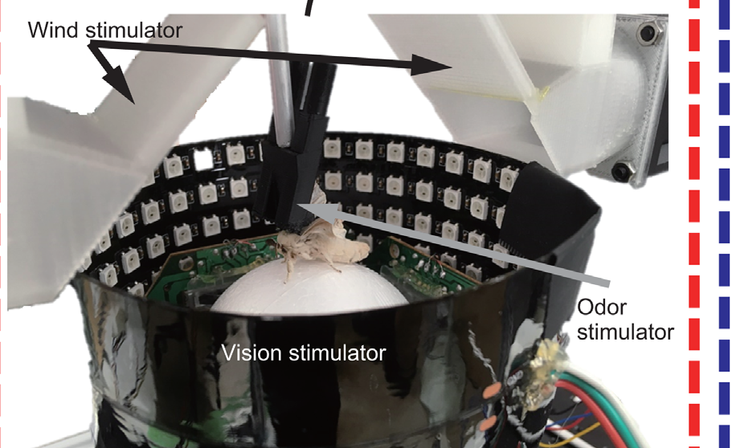
NEUR 411 · NEUROETHOLOGY · FALL 2026
Lecture 24
Chemoreception I: silkmoth pheromone plume-tracking (Kramer & Cardé)
Wednesday, October 21, 2026
Jordan Lopez, Ph.D.
Professor of Neurobiology & Biomedical Engineering
Yamada et al. (2021), Fig. 1(A, photograph). Male silkmoth on the trackball preparation.
Notes:
Chemoreception I: silkmoth pheromone plume-tracking (Kramer & Cardé)
Lecture 24. NEUR 411 · NEUROETHOLOGY · FALL 2026. Wednesday, October 21, 2026.
Figure: Yamada et al. (2021), Fig. 1(A, photograph). Male silkmoth on the trackball preparation.
Figure source: https://doi.org/10.7554/elife.72001
• Male Bombyx mori follow intermittent bombykol contacts with forward surges and searching turns. The title uses the original published photograph of a male on Yamada and colleagues’ trackball preparation.
References:
Yamada M, Ohashi H, Hosoda K, Kurabayashi D, Shigaki S (2021). Multisensory-motor integration in olfactory navigation of silkmoth, Bombyx mori, using virtual reality system. eLife 10:e72001. https://doi.org/10.7554/elife.72001

Slide 2
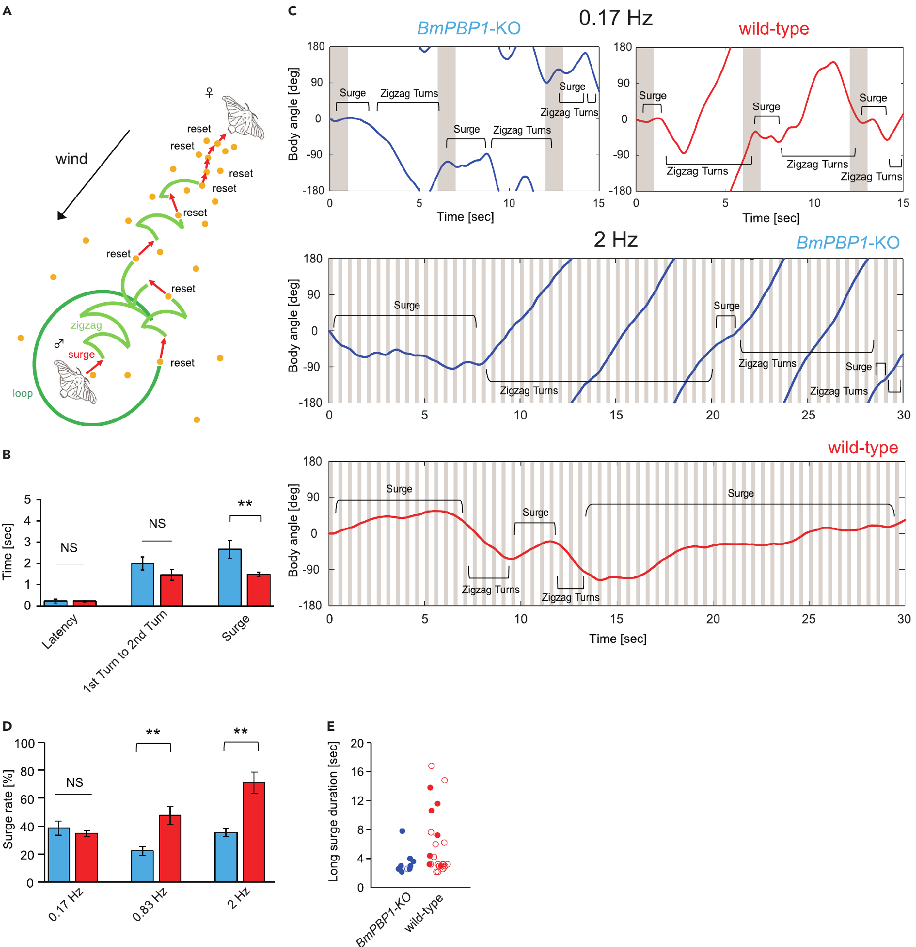
Bombykol triggers silkmoth mate searching
Pheromones are chemical signals exchanged between members of a species. Male silkmoths, Bombyx mori, respond to the female pheromone bombykol with a forward walking surge, alternating zigzag turns and wider looping search when further odor contacts are absent.
Shiota and colleagues measured body angle in tethered males and source finding during free walking. A single bombykol pulse elicited the complete searching sequence in both normal moths and moths lacking a pheromone-binding protein. Thus, the sequence could persist despite altered peripheral response kinetics.
At repeated stimulation rates of 0.83 and 2 Hz, mutants spent less time surging and more time turning. Detecting pheromone is therefore insufficient for efficient tracking: the sensory system must also distinguish successive encounters. Surging resets with each new contact, so more turning at high stimulation rates reflects poorer separation of successive contacts.
Shiota et al. (2021), Fig. 4(A–E). Surge and turning behavior after pheromone-binding-protein loss.
Shiota et al. (2021)
02
Notes:
• Pheromones are chemical signals exchanged between members of a species. Male silkmoths, Bombyx mori, respond to the female pheromone bombykol with a forward walking surge, alternating zigzag turns and wider looping search when further odor contacts are absent.
– Bombykol is the alcohol (E,Z)-10,12-hexadecadien-1-ol. A surge is forward progress rather than continuous rotation; the later zigzag phase can search for another odor encounter.
• Shiota and colleagues measured body angle in tethered males and source finding during free walking. A single bombykol pulse elicited the complete searching sequence in both normal moths and moths lacking a pheromone-binding protein. Thus, the sequence could persist despite altered peripheral response kinetics.
• At repeated stimulation rates of 0.83 and 2 Hz, mutants spent less time surging and more time turning. Detecting pheromone is therefore insufficient for efficient tracking: the sensory system must also distinguish successive encounters. Surging resets with each new contact, so more turning at high stimulation rates reflects poorer separation of successive contacts.
References:
Shiota Y, Sakurai T, Ando N, Haupt SS, Mitsuno H, Daimon T, Kanzaki R (2021). Pheromone binding protein is involved in temporal olfactory resolution in the silkmoth. iScience 24(11):103334. https://doi.org/10.1016/j.isci.2021.103334
Figure: Shiota et al. (2021), Fig. 4(A–E). Surge and turning behavior after pheromone-binding-protein loss.
Figure source: https://doi.org/10.1016/j.isci.2021.103334

Slide 3
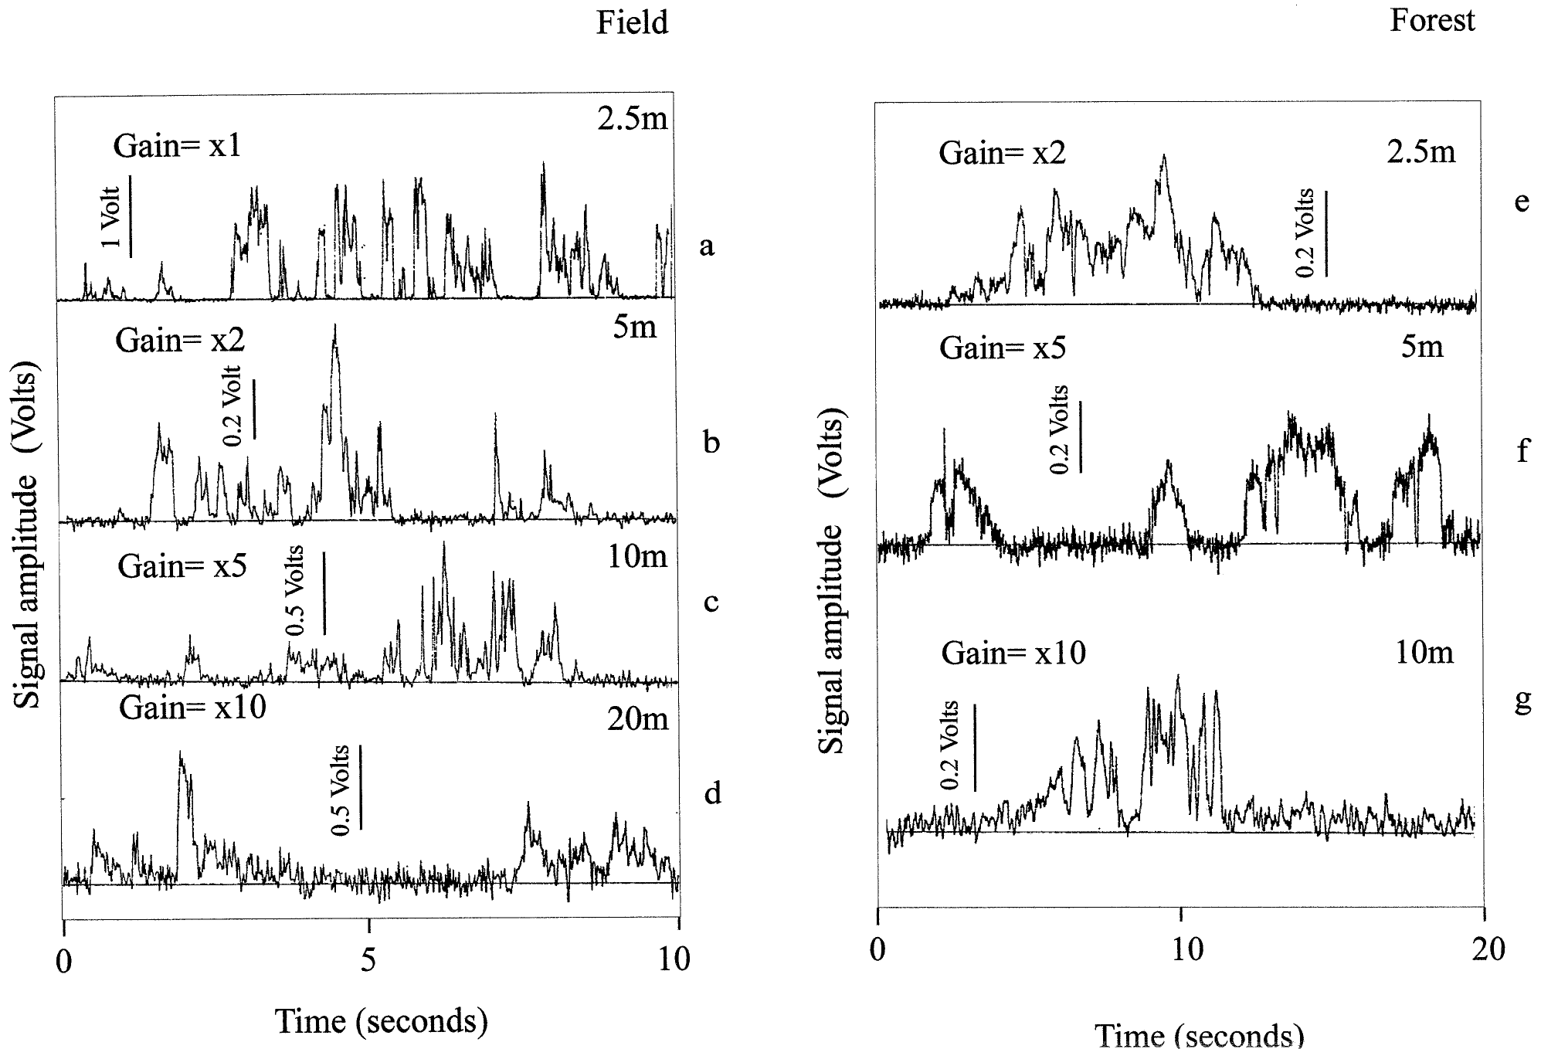
Turbulence separates odor into intermittent strands
An odor plume is the distribution of odor-bearing air transported from a source. Atmospheric turbulence divides that distribution into brief encounters separated by clean-air gaps. Murlis, Willis and Cardé measured plume intermittency in an open field and a forest rather than assuming a smooth concentration gradient.
The investigators released negatively charged air ions as a tracer and recorded fluctuations at downwind detectors. Signals were present only about 20% of the time in both environments. Sampling extended to 20 m downwind in the field and 10 m in the forest.
Odor therefore reaches a detector as brief encounters and not as a smooth gradient. Ionized air approximates plume transport, so the 20% signal occupancy describes how often a detector met the plume.
Murlis et al. (2000), Fig. 1(a–g). Intermittent ion-tracer signals at several field and forest distances.
Murlis et al. (2000)
03
Notes:
• An odor plume is the distribution of odor-bearing air transported from a source. Atmospheric turbulence divides that distribution into brief encounters separated by clean-air gaps. Murlis, Willis and Cardé measured plume intermittency in an open field and a forest rather than assuming a smooth concentration gradient.
– A filament is a strand of odor-bearing air; a gap is an interval without detectable signal. Intermittency describes those alternations, rather than the average concentration alone.
• The investigators released negatively charged air ions as a tracer and recorded fluctuations at downwind detectors. Signals were present only about 20% of the time in both environments. Sampling extended to 20 m downwind in the field and 10 m in the forest.
• Odor therefore reaches a detector as brief encounters and not as a smooth gradient. Ionized air approximates plume transport, so the 20% signal occupancy describes how often a detector met the plume.
References:
Murlis J, Willis MA, Cardé RT (2000). Spatial and temporal structures of pheromone plumes in fields and forests. Physiological Entomology 25(3):211-222. https://doi.org/10.1046/j.1365-3032.2000.00176.x
Figure: Murlis et al. (2000), Fig. 1(a–g). Intermittent ion-tracer signals at several field and forest distances.
Figure source: https://doi.org/10.1046/j.1365-3032.2000.00176.x

Slide 4
Intermittency describes how often odor is present
Intermittency is the property of a plume in which odor arrives as brief encounters separated by clean-air gaps, so a detector registers signal only part of the time. Atmospheric turbulence divides odor-bearing air into strands, and each strand passes a detector as a short burst of signal.
Murlis, Willis and Cardé released negatively charged air ions as a tracer and recorded fluctuations at downwind detectors in an open field and a forest. Signals were present only about 20% of the time in both environments, with sampling extended to 20 m downwind in the field and 10 m in the forest.
A silkmoth moving through such a plume therefore experiences a sequence of separate odor contacts and not a smooth rise in concentration. Ionized air approximates plume transport, so the tracer describes when odor could arrive, and the timing of those contacts is the stimulus that the nervous system processes.
Murlis et al. (2000), Fig. 1(a–g). Intermittent ion-tracer signals at several field and forest distances.
Murlis et al. (2000)
03a
Notes:
• Odor in moving air reaches an animal as a pattern in time and not as a smooth gradient.
• Definition.
– Intermittency is the presence of odor in brief encounters.
– Clean-air gaps separate the encounters.
• Cause.
– Atmospheric turbulence divides odor-bearing air into strands.
– Each strand passes a detector as a short burst of signal.
• Tracer.
– Negatively charged air ions served as a tracer of plume transport.
– Detectors downwind recorded the fluctuations.
• Environments.
– Measurements were made in an open field and in a forest.
– Sampling extended 20 meters downwind in the field and 10 meters in the forest.
• Occupancy.
– Signals were present only about 20 percent of the time in both environments.
– The detector saw clean air for the rest of the time.
• Consequence for the moth.
– A moving moth meets a sequence of separate contacts.
– The timing of those contacts is the stimulus that its nervous system must process.
• Practical point.
– A mean concentration averages over bursts and gaps, so it hides the structure that an animal actually meets.
References:
Murlis J, Willis MA, Cardé RT (2000). Spatial and temporal structures of pheromone plumes in fields and forests. Physiological Entomology 25(3):211-222. https://doi.org/10.1046/j.1365-3032.2000.00176.x

Slide 5
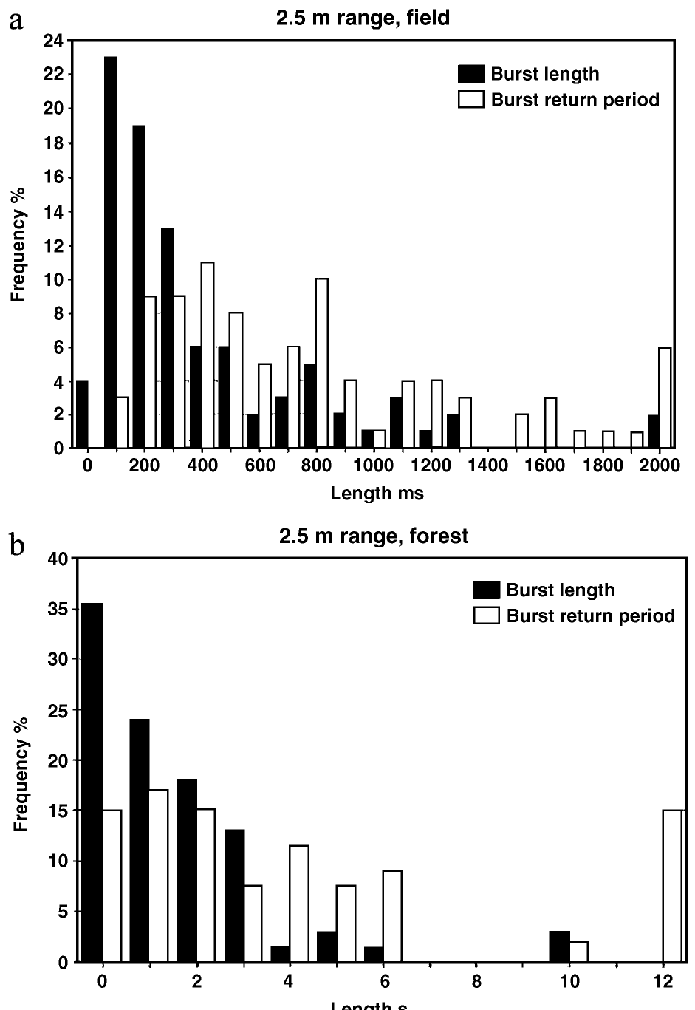
Forest plumes contain longer gaps between bursts
Bursts are groups of closely spaced tracer peaks separated by longer gaps of clean air. Murlis and colleagues compared their timing in field and forest recordings. Signal occupancy was about 20% in both environments, so equal occupancy hid large differences in how the odor arrived. Each burst therefore appears as one unit of odor input, and the spacing between units carries the information.
Forest gaps between bursts lasted at least three times longer than field gaps. A burst contained about seven tracer spikes in the forest and about three in the field. The forest plume therefore clusters its encounters, so the same fraction of time containing signal arrives in fewer and denser episodes. Burst size and gap length together set how much odor a searching animal meets in each episode.
Long clean-air gaps give a searching animal time to make movements before odor returns. A single mean concentration describes the average odor level, yet the forest plume delivers odor as clusters of about seven spikes separated by long intervals, and this temporal pattern is what the animal actually experiences. The timing of these encounters, rather than their average strength, decides whether the animal keeps moving toward the source.
Murlis et al. (2000), Fig. 2(a–b). Field and forest burst-length and burst-return-period distributions.
Murlis et al. (2000); Vickers & Baker (1994)
04
Notes:
• Bursts are groups of closely spaced tracer peaks separated by longer gaps. Murlis and colleagues compared their timing in field and forest recordings. Although signal occupancy was about 20% in both environments, equal occupancy did not imply equal patterns of odor availability.
– Burst structure distinguishes several rapid contacts followed by a long interruption from contacts distributed evenly through time. Both can have the same average occupancy.
• Forest interburst gaps lasted at least three times longer than field gaps. A burst contained about seven tracer spikes in the forest and three in the field. The environment therefore changed the clustering of encounters, even when the fraction of time containing signal was similar.
• Longer gaps can permit searching movements to develop before odor returns. Forest plumes therefore deliver odor in clusters of about seven spikes separated by long clean-air intervals. A single mean concentration cannot describe the temporal challenge imposed by these plumes.
References:
Murlis J, Willis MA, Cardé RT (2000). Spatial and temporal structures of pheromone plumes in fields and forests. Physiological Entomology 25(3):211-222. https://doi.org/10.1046/j.1365-3032.2000.00176.x
Vickers NJ, Baker TC (1994). Reiterative responses to single strands of odor promote sustained upwind flight and odor source location by moths. Proceedings of the National Academy of Sciences 91(13):5756-5760. https://doi.org/10.1073/pnas.91.13.5756
Figure: Murlis et al. (2000), Fig. 2(a–b). Field and forest burst-length and burst-return-period distributions.
Figure source: https://doi.org/10.1046/j.1365-3032.2000.00176.x

Slide 6
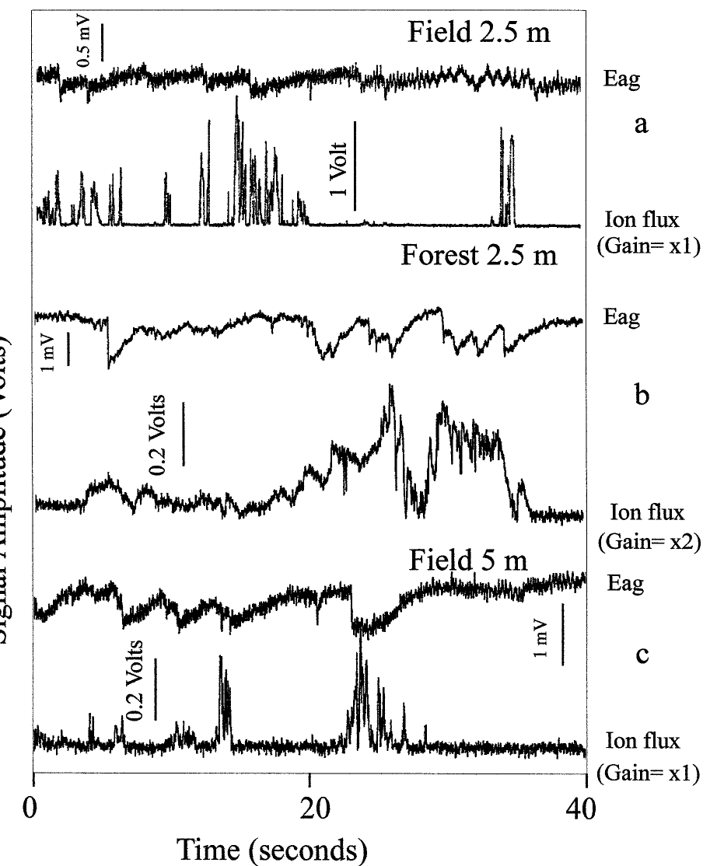
Antennal voltage is an imperfect odor readout
An electroantennogram, or EAG, measures the summed electrical response of an antenna to odor. Murlis and colleagues paired ion-tracer measurements with male gypsy-moth antennal responses to the pheromone disparlure. This biological comparison tested whether tracer intermittency resembled stimulation reaching an insect sensory organ.
The pheromone source was positioned about 10 cm from the ion source. Ion bursts became weaker with distance, whereas EAG burst strength did not decrease in the same systematic way. Antennal responses also depended on how quickly consecutive stimuli arrived.
EAG voltage is therefore not a simple linear measure of airborne pheromone concentration. Receptor sensitivity and recovery shape the recorded waveform. The recordings therefore validate aspects of plume encounter timing even though amplitude does not track concentration.
Murlis et al. (2000), Fig. 5(a–c). Ion-tracer signals compared with gypsy-moth antennal responses.
Murlis et al. (2000)
05
Notes:
• An electroantennogram, or EAG, measures the summed electrical response of an antenna to odor. Murlis and colleagues paired ion-tracer measurements with male gypsy-moth antennal responses to the pheromone disparlure. This biological comparison tested whether tracer intermittency resembled stimulation reaching an insect sensory organ.
– The comparison involves Lymantria dispar and disparlure. The animal and ligand differ from Bombyx mori and bombykol, although both assays address intermittent antennal stimulation.
• The pheromone source was positioned about 10 cm from the ion source. Ion bursts became weaker with distance, whereas EAG burst strength did not decrease in the same systematic way. Antennal responses also depended on how quickly consecutive stimuli arrived.
• EAG voltage is therefore not a simple linear measure of airborne pheromone concentration. Receptor sensitivity and recovery shape the recorded waveform. The recordings therefore validate aspects of plume encounter timing even though amplitude does not track concentration.
References:
Murlis J, Willis MA, Cardé RT (2000). Spatial and temporal structures of pheromone plumes in fields and forests. Physiological Entomology 25(3):211-222. https://doi.org/10.1046/j.1365-3032.2000.00176.x
Figure: Murlis et al. (2000), Fig. 5(a–c). Ion-tracer signals compared with gypsy-moth antennal responses.
Figure source: https://doi.org/10.1046/j.1365-3032.2000.00176.x

Slide 7
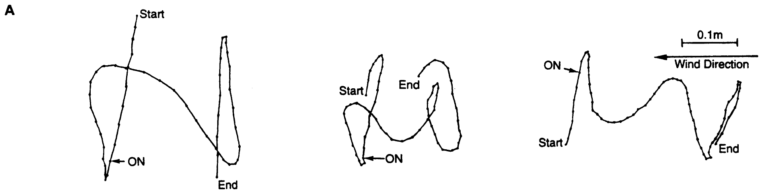
One odor strand evokes a short upwind surge
Vickers and Baker exposed flying male tobacco budworms, Heliothis virescens, to single strands of their species-specific six-component pheromone blend. After interrupting an established plume, they delivered an isolated filament and synchronized its passage with calibrated lights moving at wind speed.
The average upwind surge covered 13.4 cm and lasted 0.38 s. Its onset followed odor contact by about 0.30 s. Males cast across the wind before and after the surge; no-filament control trials produced no upwind displacement by casting males.
A brief sensory event can therefore trigger a motor response that outlasts the event. Onset about 0.30 s after contact and a surge lasting 0.38 s give a single strand a defined burst of upwind progress.
Vickers & Baker (1994), Fig. 1(A). Recorded flight responses to single pheromone filaments.
Vickers & Baker (1994)
06
Notes:
• Vickers and Baker exposed flying male tobacco budworms, Heliothis virescens, to single strands of their species-specific six-component pheromone blend. After interrupting an established plume, they delivered an isolated filament and synchronized its passage with calibrated lights moving at wind speed.
– Casting means repeated crosswind turns after odor contact is lost. The authors combined observations into a proposed phasic–tonic account, but the individual recorded tracks remain distinct from their calculated template.
• The average upwind surge covered 13.4 cm and lasted 0.38 s. Its onset followed odor contact by about 0.30 s. Males cast across the wind before and after the surge; no-filament control trials produced no upwind displacement by casting males.
• A brief sensory event can therefore trigger a motor response that outlasts the event. Onset about 0.30 s after contact and a surge lasting 0.38 s give a single strand a defined burst of upwind progress.
References:
Vickers NJ, Baker TC (1994). Reiterative responses to single strands of odor promote sustained upwind flight and odor source location by moths. Proceedings of the National Academy of Sciences 91(13):5756-5760. https://doi.org/10.1073/pnas.91.13.5756
Figure: Vickers & Baker (1994), Fig. 1(A). Recorded flight responses to single pheromone filaments.
Figure source: https://doi.org/10.1073/pnas.91.13.5756

Slide 8
Casting is crosswind flight after odor is lost
Casting is a search flight in which a male moves back and forth across the wind after losing contact with odor. It occurs before and after the upwind surge that follows a contact, and the alternation of the two movements makes up flight tracking of a plume.
Vickers and Baker exposed flying male tobacco budworms, Heliothis virescens, to a single strand of their six-component pheromone blend after interrupting an established plume. Males cast across the wind before and after the surge, and the average upwind surge covered 13.4 cm and lasted 0.38 s.
No-filament control trials produced no upwind displacement by casting males, so the surge depends on contact with the strand. Onset followed odor contact by about 0.30 s, which means that a single brief contact converts crosswind casting into a short burst of upwind progress.
Vickers & Baker (1994), Fig. 1(A). Recorded flight responses to single pheromone filaments.
Vickers & Baker (1994)
06a
Notes:
• Casting is the search movement that a male performs when odor is absent.
• Definition.
– Casting is flight back and forth across the wind.
– It follows the loss of contact with the odor.
• Subjects.
– Flying male tobacco budworms, Heliothis virescens, were tested.
– They responded to their species-specific six-component pheromone blend.
• Single strand.
– An established plume was interrupted first.
– An isolated filament was then delivered and synchronized with lights moving at wind speed.
• Surge numbers.
– The average upwind surge covered 13.4 centimeters.
– It lasted 0.38 seconds and began about 0.30 seconds after contact.
• Controls.
– No-filament trials produced no upwind displacement by casting males.
• Meaning.
– A brief odor contact converts casting into upwind progress.
– The surge depends on contact with the strand.
• Timing relation.
– Contact comes first, the surge begins about 0.30 seconds later, and casting resumes after the surge.
– The sequence is repeatable across trials.
• Species note.
– The tested animals were flying tobacco budworms, not walking silkmoths.
– Their numerical latency belongs to that species.
• Synchronization.
– Lights moving at wind speed were synchronized with the passage of the filament.
– Timing can then be compared across trials.
References:
Vickers NJ, Baker TC (1994). Reiterative responses to single strands of odor promote sustained upwind flight and odor source location by moths. Proceedings of the National Academy of Sciences 91(13):5756-5760. https://doi.org/10.1073/pnas.91.13.5756

Slide 9
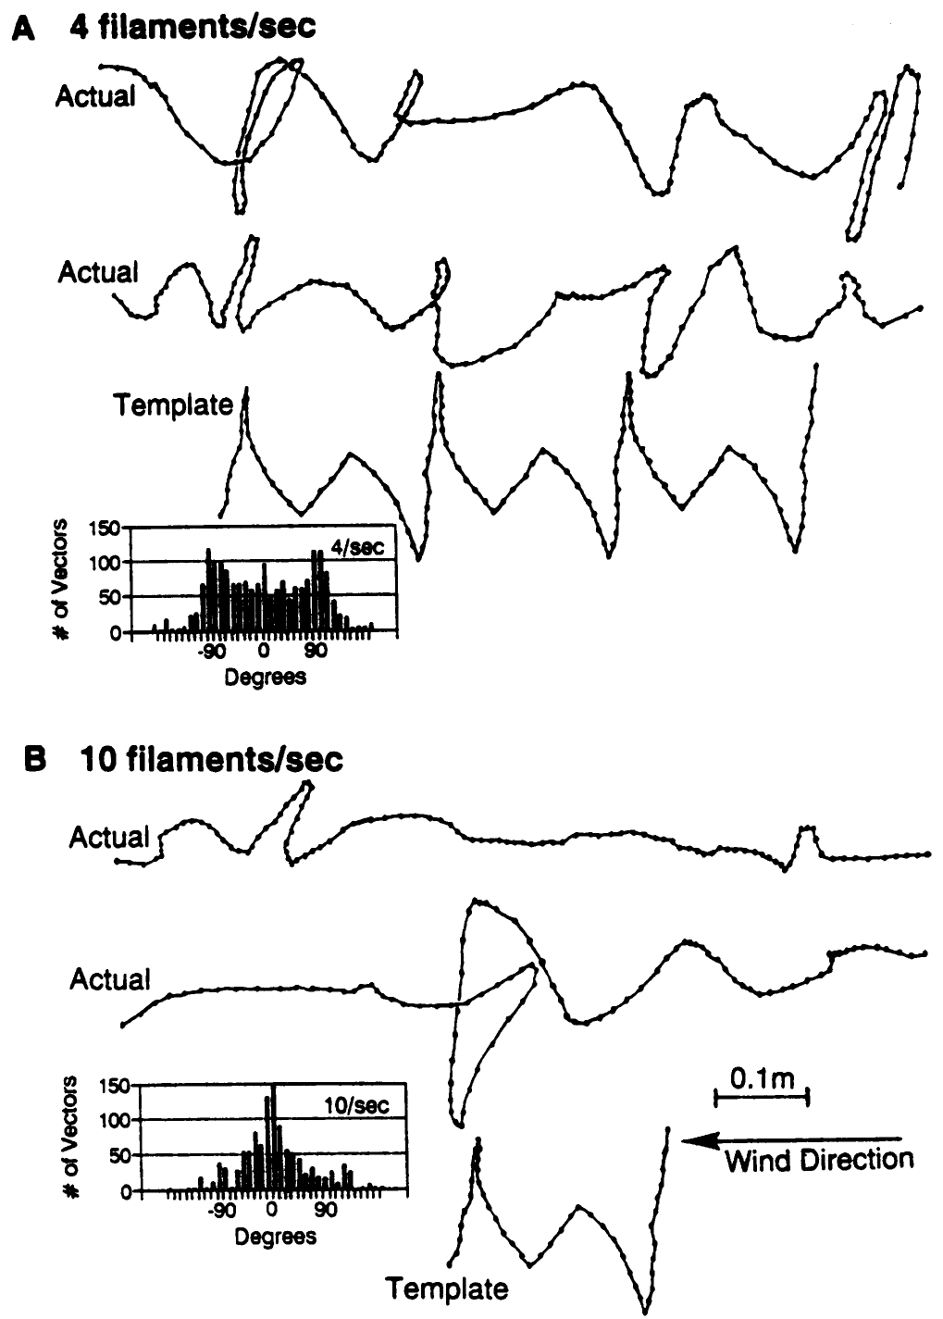
Frequent contacts sustain straighter upwind flight
Vickers and Baker varied pheromone delivery from 1 to 10 filaments/s while holding wind speed at 0.6 m/s. Each pulse lasted 20 ms, and air flow through the delivery device remained 5 mL/s. Flight trajectories were recorded from below the wind tunnel.
Fewer than 4 filaments/s activated males and elicited casting but did not sustain upwind flight. At 4 filaments/s, upwind trajectories remained tortuous. At 10 filaments/s, flight was straighter and contained less crosswind casting; 5 filaments/s produced an intermediate pattern.
Repeated encounters can renew forward responses before casting fully develops. Constant wind speed at 0.6 m/s excludes wind-velocity changes, so flight straightness tracks the rate of odor contact.
Vickers & Baker (1994), Fig. 2(A–B). Recorded flight tracks and heading distributions at 4 and 10 filaments/s.
Vickers & Baker (1994)
07
Notes:
• Vickers and Baker varied pheromone delivery from 1 to 10 filaments/s while holding wind speed at 0.6 m/s. Each pulse lasted 20 ms, and air flow through the delivery device remained 5 mL/s. Flight trajectories were recorded from below the wind tunnel.
– The published figure contains recorded tracks and an author-derived comparison template. The template is a proposed description of repeated responses, rather than an additional animal trajectory.
• Fewer than 4 filaments/s activated males and elicited casting but did not sustain upwind flight. At 4 filaments/s, upwind trajectories remained tortuous. At 10 filaments/s, flight was straighter and contained less crosswind casting; 5 filaments/s produced an intermediate pattern.
• Repeated encounters can renew forward responses before casting fully develops. Constant wind speed at 0.6 m/s excludes wind-velocity changes, so flight straightness tracks the rate of odor contact.
References:
Vickers NJ, Baker TC (1994). Reiterative responses to single strands of odor promote sustained upwind flight and odor source location by moths. Proceedings of the National Academy of Sciences 91(13):5756-5760. https://doi.org/10.1073/pnas.91.13.5756
Figure: Vickers & Baker (1994), Fig. 2(A–B). Recorded flight tracks and heading distributions at 4 and 10 filaments/s.
Figure source: https://doi.org/10.1073/pnas.91.13.5756

Slide 10
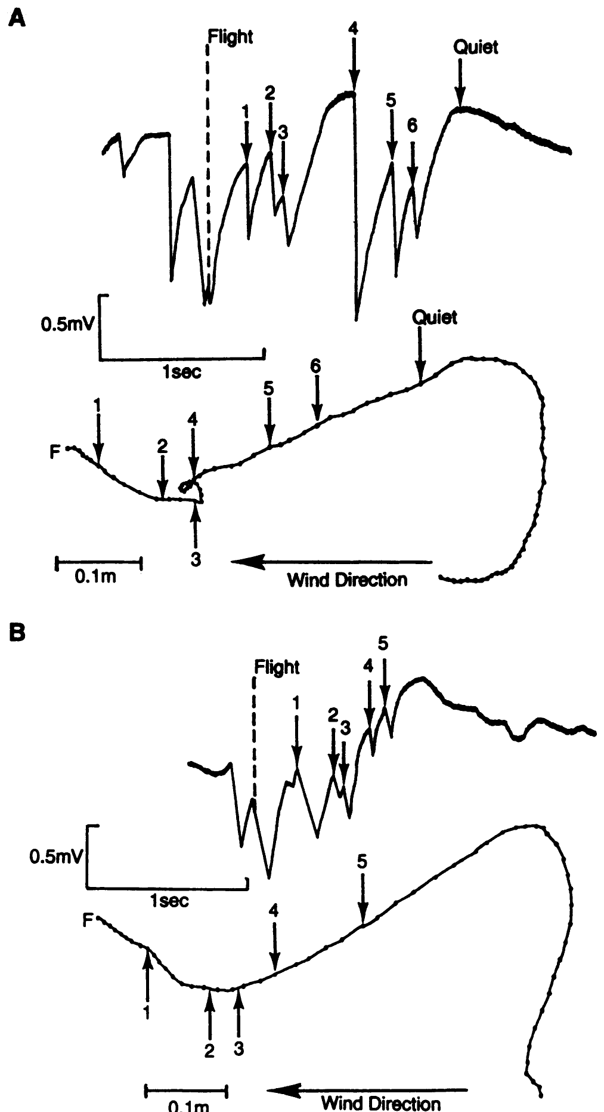
Casting follows the loss of detectable odor
Vickers and Baker recorded local pheromone encounters during free flight using an excised third antenna mounted on a male’s thorax. Both of the animal’s own antennae remained intact. The mounted antenna supplied an EAG while synchronized video recorded the carrier’s trajectory.
Casting began on average 0.30 s after the last recorded filament contact. Relatively steady upwind flight involved more frequent encounters than crosswind flight. The video and EAG records were synchronized within 0.01 s, allowing behavioral timing to be compared with local sensory exposure.
Loss of intermittent input can release a different search movement without requiring the moth to detect a spatial concentration gradient. Casting began about 0.30 s after the last contact, so the end of input releases the crosswind search.
Vickers & Baker (1994), Fig. 3(A–B). Flight paths synchronized with local electroantennogram contacts.
Vickers & Baker (1994)
08
Notes:
• Vickers and Baker recorded local pheromone encounters during free flight using an excised third antenna mounted on a male’s thorax. Both of the animal’s own antennae remained intact. The mounted antenna supplied an EAG while synchronized video recorded the carrier’s trajectory.
– A disappearing EAG signal marks the absence of a detected local encounter, rather than proving that every receptor on both intact antennae became silent at precisely that instant.
• Casting began on average 0.30 s after the last recorded filament contact. Relatively steady upwind flight involved more frequent encounters than crosswind flight. The video and EAG records were synchronized within 0.01 s, allowing behavioral timing to be compared with local sensory exposure.
• Loss of intermittent input can release a different search movement without requiring the moth to detect a spatial concentration gradient. Casting began about 0.30 s after the last contact, so the end of input releases the crosswind search.
References:
Vickers NJ, Baker TC (1994). Reiterative responses to single strands of odor promote sustained upwind flight and odor source location by moths. Proceedings of the National Academy of Sciences 91(13):5756-5760. https://doi.org/10.1073/pnas.91.13.5756
Figure: Vickers & Baker (1994), Fig. 3(A–B). Flight paths synchronized with local electroantennogram contacts.
Figure source: https://doi.org/10.1073/pnas.91.13.5756

Slide 11
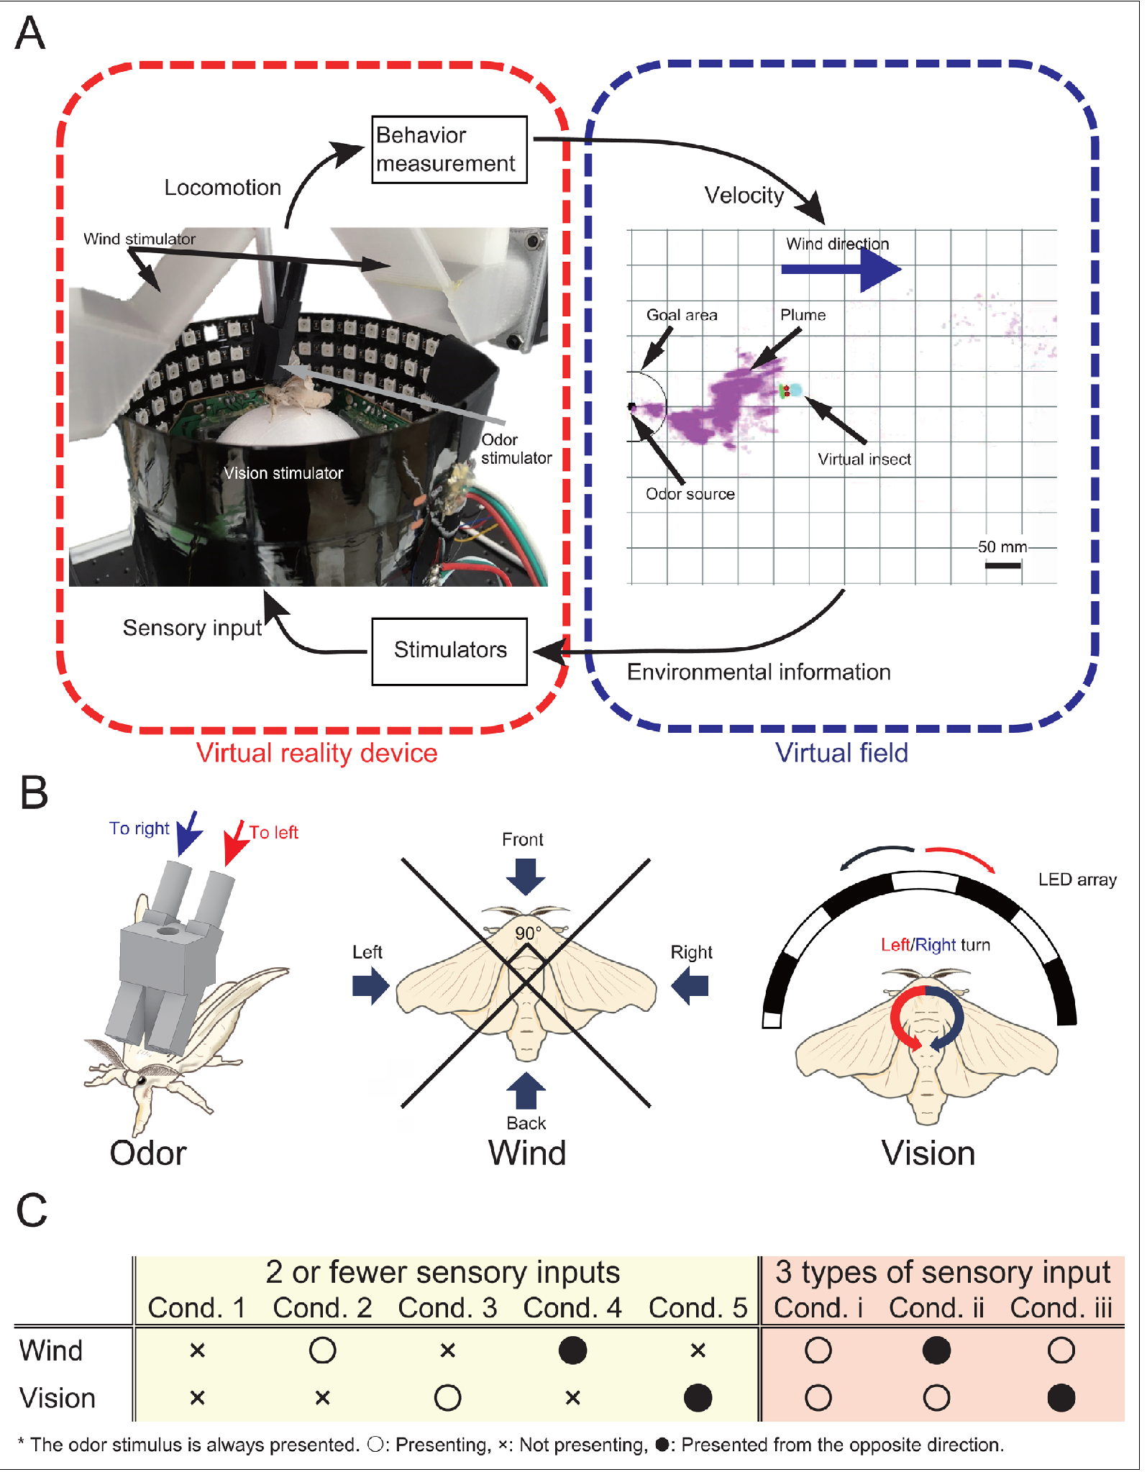
A trackball separates odor, wind and visual inputs
Yamada and colleagues studied walking male Bombyx mori using a virtual reality preparation: movement on a trackball updated the animal’s position in a controlled odor field. Odor ports could stimulate the two antennae independently, while wind arrived from four directions.
Visual stimulation supplied optic flow, the movement of a visual scene associated with self-motion. Odor, wind and visual conditions could be combined or reversed independently. A search was successful when the virtual position entered a 10-mm radius around the source within 300 s.
This preparation separates sensory influences that normally covary during walking. Moving the trackball updates the virtual position, so each cue can be reversed or removed while the others stay controlled and success is scored at 10 mm from the source.
Yamada et al. (2021), Fig. 1(A–C). Photograph and published sensory-control preparation.
Yamada et al. (2021)
09
Notes:
• Yamada and colleagues studied walking male Bombyx mori using a virtual reality preparation: movement on a trackball updated the animal’s position in a controlled odor field. Odor ports could stimulate the two antennae independently, while wind arrived from four directions.
– Closed-loop stimulation means the sensory inputs depend on the animal’s measured movement. Movement and input influence one another instead of following an entirely predetermined replay.
• Visual stimulation supplied optic flow, the movement of a visual scene associated with self-motion. Odor, wind and visual conditions could be combined or reversed independently. A search was successful when the virtual position entered a 10-mm radius around the source within 300 s.
• This preparation separates sensory influences that normally covary during walking. Moving the trackball updates the virtual position, so each cue can be reversed or removed while the others stay controlled and success is scored at 10 mm from the source.
References:
Yamada M, Ohashi H, Hosoda K, Kurabayashi D, Shigaki S (2021). Multisensory-motor integration in olfactory navigation of silkmoth, Bombyx mori, using virtual reality system. eLife 10:e72001. https://doi.org/10.7554/elife.72001
Figure: Yamada et al. (2021), Fig. 1(A–C). Photograph and published sensory-control preparation.
Figure source: https://doi.org/10.7554/elife.72001

Slide 12
Optic flow is visual motion caused by self-motion
Optic flow is the movement of a visual scene across the eyes that is produced by the animal's own motion. Its direction and speed tell a walking animal how it is moving relative to its surroundings.
Yamada and colleagues studied walking male Bombyx mori on a trackball that updated the animal's position in a controlled odor field. Visual stimulation supplied optic flow, odor ports stimulated the two antennae independently, and wind arrived from four directions. Odor, wind and visual conditions could be combined or reversed independently.
A search was successful when the virtual position entered a 10-mm radius around the source within 300 s. Reversing the direction of optic flow therefore tests whether the moth uses visual feedback about its own movement while it follows odor.
Yamada et al. (2021), Fig. 1(A–C). Photograph and published sensory-control preparation.
Yamada et al. (2021)
09a
Notes:
• Visual motion is one of three cues that the virtual preparation controls.
• Definition.
– Optic flow is the movement of a visual scene associated with self-motion.
– The animal's own movement produces it.
• Preparation.
– Walking males moved on a trackball.
– Movement updated the position of the animal in a controlled odor field.
• Other cues.
– Odor ports stimulated the two antennae independently.
– Wind arrived from four directions.
• Independent control.
– Odor, wind and visual conditions could be combined or reversed independently.
• Success criterion.
– A search was successful when the virtual position entered a 10-millimeter radius around the source.
– The limit was 300 seconds.
• Meaning.
– Reversing optic flow tests whether visual feedback contributes to odor-guided walking.
• Why a virtual setup.
– On a trackball the experimenter sets where the animal appears to be.
– Cues that normally covary during walking can be separated.
• Wind and antennae.
– Wind could come from four directions.
– The two antennae could be stimulated independently.
• Comparison.
– Performance was compared with free-walking experiments.
– The virtual setup measures multisensory behavior.
References:
Yamada M, Ohashi H, Hosoda K, Kurabayashi D, Shigaki S (2021). Multisensory-motor integration in olfactory navigation of silkmoth, Bombyx mori, using virtual reality system. eLife 10:e72001. https://doi.org/10.7554/elife.72001

Slide 13
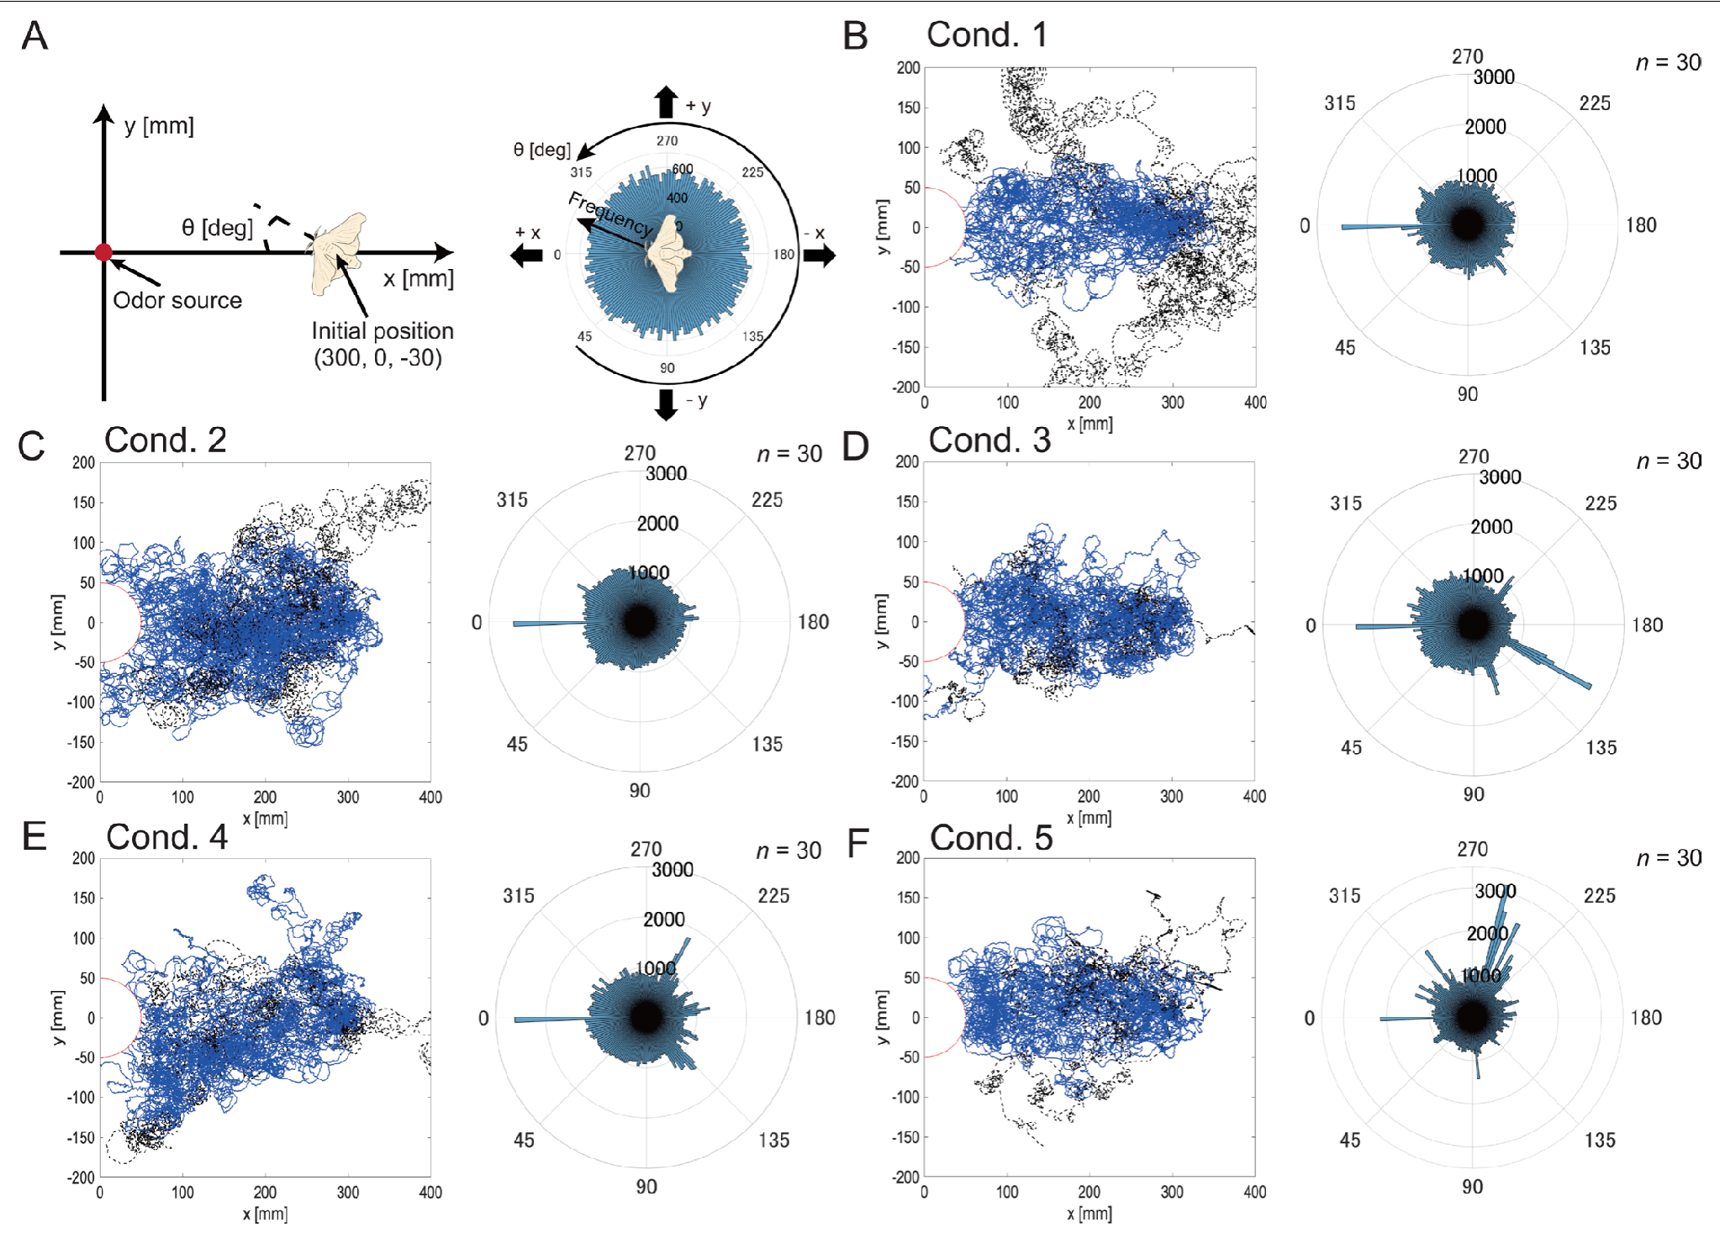
Wind information steers walking toward the source
In the virtual-reality study, males received odor alone, odor plus wind, or odor plus visual motion. Additional treatments reversed wind or visual direction while keeping the other available information controlled. These interventions tested the contribution of cue direction rather than simply increasing stimulation.
Correctly aligned wind improved source-finding success relative to odor alone. Reversed wind reduced success and increased downwind headings. Visual motion without wind produced trajectories more similar to odor-only search than did the addition of wind.
Anemotaxis is orientation relative to wind. Aligned wind raised success and reversed wind increased downwind headings, so wind direction supplies steering information while visual effects depend on the sensory context.
Yamada et al. (2021), Fig. 2(A–F). Walking paths with odor, wind and visual treatments.
Yamada et al. (2021)
10
Notes:
• In the virtual-reality study, males received odor alone, odor plus wind, or odor plus visual motion. Additional treatments reversed wind or visual direction while keeping the other available information controlled. These interventions tested the contribution of cue direction rather than simply increasing stimulation.
– Odor signals that an appropriate chemical has arrived; wind can supply information about transport direction. Reversing that direction creates a conflict between sensory cues rather than removing odor detection.
• Correctly aligned wind improved source-finding success relative to odor alone. Reversed wind reduced success and increased downwind headings. Visual motion without wind produced trajectories more similar to odor-only search than did the addition of wind.
• Anemotaxis is orientation relative to wind. Aligned wind raised success and reversed wind increased downwind headings, so wind direction supplies steering information while visual effects depend on the sensory context.
References:
Yamada M, Ohashi H, Hosoda K, Kurabayashi D, Shigaki S (2021). Multisensory-motor integration in olfactory navigation of silkmoth, Bombyx mori, using virtual reality system. eLife 10:e72001. https://doi.org/10.7554/elife.72001
Figure: Yamada et al. (2021), Fig. 2(A–F). Walking paths with odor, wind and visual treatments.
Figure source: https://doi.org/10.7554/elife.72001

Slide 14
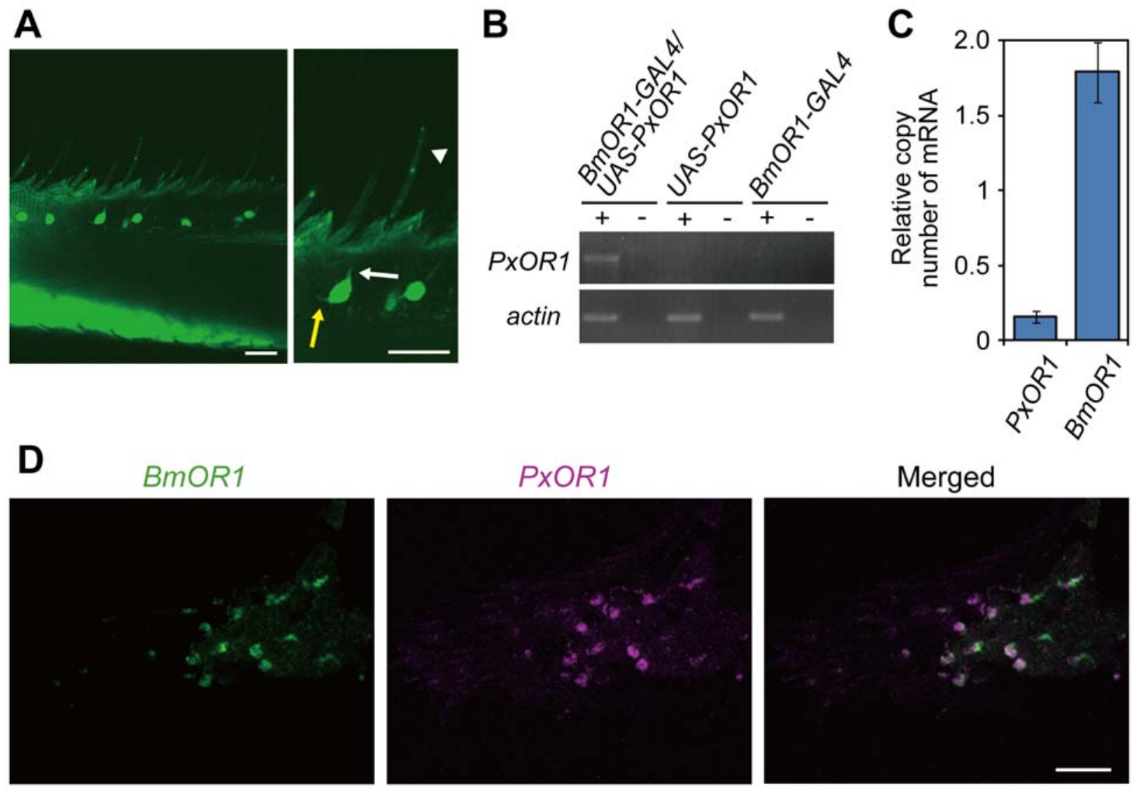
Bombykol detection begins in antennal sensory hairs
Olfactory receptor neurons, or ORNs, are sensory cells that convert odor exposure into electrical activity. In male Bombyx mori, long sensilla trichodea, hairlike structures on the antenna, house paired pheromone-responsive neurons. Their sensory endings contact the fluid inside each sensillum.
Sakurai and colleagues used receptor-gene expression, fluorescent labeling and in situ hybridization to identify the bombykol-responsive population. BmOR1 is the ligand-selective receptor expressed by these neurons; the neighboring bombykal-responsive neuron expresses BmOR3. Bombykal is the corresponding aldehyde rather than the alcohol bombykol.
The separate receptor populations distinguish chemical channels before central processing. Hairs housing BmOR1 neurons therefore detect bombykol, while the neighboring BmOR3 neuron detects bombykal.
Sakurai et al. (2011), Fig. 1(A–D). Receptor expression and sensory-cell localization in the antenna.
Sakurai et al. (2011)
11
Notes:
• Olfactory receptor neurons, or ORNs, are sensory cells that convert odor exposure into electrical activity. In male Bombyx mori, long sensilla trichodea, hairlike structures on the antenna, house paired pheromone-responsive neurons. Their sensory endings contact the fluid inside each sensillum.
– In situ hybridization detects a chosen RNA sequence within cells. Its localization is evidence about gene expression, whereas a neuronal spike recording measures the electrical consequence of stimulation.
• Sakurai and colleagues used receptor-gene expression, fluorescent labeling and in situ hybridization to identify the bombykol-responsive population. BmOR1 is the ligand-selective receptor expressed by these neurons; the neighboring bombykal-responsive neuron expresses BmOR3. Bombykal is the corresponding aldehyde rather than the alcohol bombykol.
• The separate receptor populations distinguish chemical channels before central processing. Hairs housing BmOR1 neurons therefore detect bombykol, while the neighboring BmOR3 neuron detects bombykal.
References:
Sakurai T, Mitsuno H, Haupt SS, Uchino K, Yokohari F, Nishioka T, Kobayashi I, Sezutsu H, Tamura T, Kanzaki R (2011). A Single Sex Pheromone Receptor Determines Chemical Response Specificity of Sexual Behavior in the Silkmoth Bombyx mori. PLoS Genetics 7(6):e1002115. https://doi.org/10.1371/journal.pgen.1002115
Figure: Sakurai et al. (2011), Fig. 1(A–D). Receptor expression and sensory-cell localization in the antenna.
Figure source: https://doi.org/10.1371/journal.pgen.1002115

Slide 15
A sensillum houses the pheromone-sensitive neurons
A sensillum is a hairlike sensory structure on the antenna that houses one or more sensory neurons. In male Bombyx mori, long sensilla trichodea contain paired pheromone-responsive neurons whose sensory endings contact the fluid inside each hair.
Sakurai and colleagues used receptor-gene expression, fluorescent labeling and in situ hybridization to identify the neurons. The bombykol-responsive neuron expresses the ligand-selective receptor BmOR1, and the neighboring neuron expresses BmOR3 and responds to bombykal, the corresponding aldehyde.
Each hair therefore holds two separate chemical channels side by side. Because the two neurons share one sensillum but express different receptors, the identity of a pheromone component is set by which neuron is excited, before any central processing.
Sakurai et al. (2011), Fig. 1(A–D). Receptor expression and sensory-cell localization in the antenna.
Sakurai et al. (2011)
11a
Notes:
• Pheromone detection starts in a small, defined unit on the antenna.
• Definition.
– A sensillum is a hairlike sensory structure.
– It houses sensory neurons.
• Silkmoth hairs.
– Long sensilla trichodea of male Bombyx mori contain paired pheromone-responsive neurons.
– Their sensory endings contact the fluid inside the hair.
• Identification.
– Receptor-gene expression, fluorescent labeling and in situ hybridization identified the neurons.
• Two receptors.
– BmOR1 is expressed in the bombykol-responsive neuron.
– BmOR3 is expressed in the neighboring bombykal-responsive neuron.
• Two ligands.
– Bombykol is an alcohol.
– Bombykal is the corresponding aldehyde.
• Meaning.
– Which neuron is excited identifies the chemical, before any central processing.
• Why paired neurons matter.
– Two neurons in one hair give two chemical channels at one location on the antenna.
– Their receptors, BmOR1 and BmOR3, are different.
• Experimental tools.
– Receptor-gene expression shows which neurons make which receptor.
– Fluorescent labeling and in situ hybridization locate the expressing cells.
• Channels.
– The bombykol channel and the bombykal channel are separate before central processing.
References:
Sakurai T, Mitsuno H, Haupt SS, Uchino K, Yokohari F, Nishioka T, Kobayashi I, Sezutsu H, Tamura T, Kanzaki R (2011). A Single Sex Pheromone Receptor Determines Chemical Response Specificity of Sexual Behavior in the Silkmoth Bombyx mori. PLoS Genetics 7(6):e1002115. https://doi.org/10.1371/journal.pgen.1002115

Slide 16
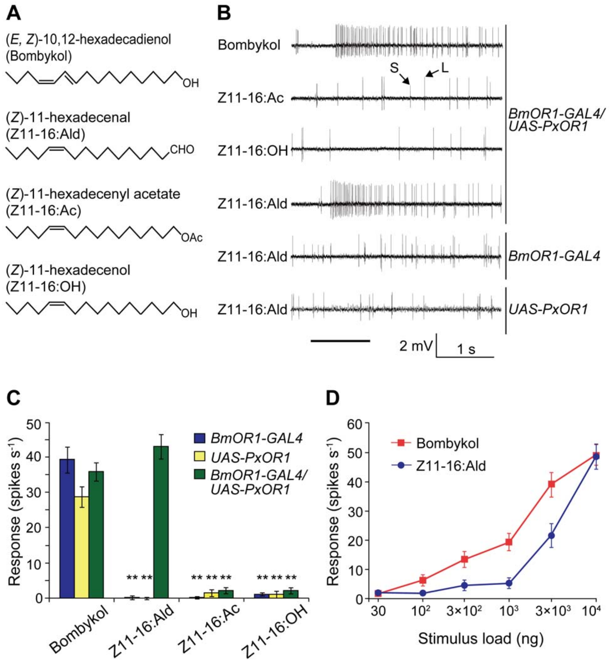
Distinct receptor neurons resolve pheromone identity
A single-sensillum recording measures spikes near the sensory neurons housed in one antennal hair. Sakurai and colleagues distinguished the large-amplitude spikes of the bombykol neuron from the smaller spikes of the bombykal neuron while presenting chemically different ligands.
Control males responded through the bombykol channel to bombykol but not to the diamondback-moth ligand Z11-16:Ald. Introducing its receptor, PxOR1, into BmOR1-expressing neurons added responses to that aldehyde while retaining the original bombykol response.
The manipulation changed which chemical could excite an existing sensory channel. Spike amplitude separates the two recorded units in this preparation, so the bombykol neuron can be monitored independently of the bombykal neuron.
Sakurai et al. (2011), Fig. 2(A–D). Chemical selectivity and single-sensillum responses after receptor addition.
Sakurai et al. (2011), Fig. 1(A–D). Receptor expression and sensory-cell localization in the antenna.
Sakurai et al. (2011)
12
Notes:
• A single-sensillum recording measures spikes near the sensory neurons housed in one antennal hair. Sakurai and colleagues distinguished the large-amplitude spikes of the bombykol neuron from the smaller spikes of the bombykal neuron while presenting chemically different ligands.
– The foreign receptor came from Plutella xylostella. Adding it to Bombyx neurons tests the relationship between molecular ligand recognition and the behavioral pathway already connected to those neurons.
• Control males responded through the bombykol channel to bombykol but not to the diamondback-moth ligand Z11-16:Ald. Introducing its receptor, PxOR1, into BmOR1-expressing neurons added responses to that aldehyde while retaining the original bombykol response.
• The manipulation changed which chemical could excite an existing sensory channel. Spike amplitude separates the two recorded units in this preparation, so the bombykol neuron can be monitored independently of the bombykal neuron.
References:
Sakurai T, Mitsuno H, Haupt SS, Uchino K, Yokohari F, Nishioka T, Kobayashi I, Sezutsu H, Tamura T, Kanzaki R (2011). A Single Sex Pheromone Receptor Determines Chemical Response Specificity of Sexual Behavior in the Silkmoth Bombyx mori. PLoS Genetics 7(6):e1002115. https://doi.org/10.1371/journal.pgen.1002115
Figure: Sakurai et al. (2011), Fig. 2(A–D). Chemical selectivity and single-sensillum responses after receptor addition.
Figure source: https://doi.org/10.1371/journal.pgen.1002115
Figure: Sakurai et al. (2011), Fig. 1(A–D). Receptor expression and sensory-cell localization in the antenna.
Figure source: https://doi.org/10.1371/journal.pgen.1002115

Slide 17
A foreign receptor adds a new sensory response
Sakurai and colleagues used the GAL4/UAS system, a genetic driver-and-target arrangement, to express PxOR1 in Bombyx bombykol-responsive neurons. PxOR1 was added alongside the native receptor rather than replacing or deleting BmOR1. Males bearing only one genetic component served as controls.
The manipulated neurons gained responses to Z11-16:Ald but not the corresponding tested acetate and alcohol compounds. Dose-response recordings retained responsiveness to bombykol. The added receptor’s transcript abundance was approximately ten times lower than that of native BmOR1.
Chemical selectivity can therefore change without changing the identity of the sensory pathway. Lower expression of the added receptor, about one tenth of native BmOR1 transcript, may contribute to differing response thresholds.
Sakurai et al. (2011), Fig. 2(A–D). Chemical selectivity and single-sensillum responses after receptor addition.
Sakurai et al. (2011), Fig. 1(A–D). Receptor expression and sensory-cell localization in the antenna.
Sakurai et al. (2011)
13
Notes:
• Sakurai and colleagues used the GAL4/UAS system, a genetic driver-and-target arrangement, to express PxOR1 in Bombyx bombykol-responsive neurons. PxOR1 was added alongside the native receptor rather than replacing or deleting BmOR1. Males bearing only one genetic component served as controls.
– Genetic targeting restricts the added receptor to a selected cell population. Single-component controls test whether the complete expression system is necessary for the new ligand response.
• The manipulated neurons gained responses to Z11-16:Ald but not the corresponding tested acetate and alcohol compounds. Dose-response recordings retained responsiveness to bombykol. The added receptor’s transcript abundance was approximately ten times lower than that of native BmOR1.
• Chemical selectivity can therefore change without changing the identity of the sensory pathway. Lower expression of the added receptor, about one tenth of native BmOR1 transcript, may contribute to differing response thresholds.
References:
Sakurai T, Mitsuno H, Haupt SS, Uchino K, Yokohari F, Nishioka T, Kobayashi I, Sezutsu H, Tamura T, Kanzaki R (2011). A Single Sex Pheromone Receptor Determines Chemical Response Specificity of Sexual Behavior in the Silkmoth Bombyx mori. PLoS Genetics 7(6):e1002115. https://doi.org/10.1371/journal.pgen.1002115
Figure: Sakurai et al. (2011), Fig. 2(A–D). Chemical selectivity and single-sensillum responses after receptor addition.
Figure source: https://doi.org/10.1371/journal.pgen.1002115
Figure: Sakurai et al. (2011), Fig. 1(A–D). Receptor expression and sensory-cell localization in the antenna.
Figure source: https://doi.org/10.1371/journal.pgen.1002115

Slide 18
The GAL4/UAS system targets a gene to chosen neurons
The GAL4/UAS system is a genetic driver-and-target arrangement. A driver line expresses the transcription factor GAL4 in chosen cells, and a target line carries a gene behind a UAS sequence, so the gene is expressed only in animals that carry both components.
Sakurai and colleagues used the system to express PxOR1, the diamondback-moth receptor, in Bombyx bombykol-responsive neurons. PxOR1 was added alongside the native receptor and did not replace or delete BmOR1. Males bearing only one genetic component served as controls.
The controls hold the genetic background constant, so a new response appears only when driver and target are combined. The manipulated neurons gained responses to Z11-16:Ald and retained bombykol responsiveness, which identifies the added receptor as the cause.
Sakurai et al. (2011), Fig. 2(A–D). Chemical selectivity and single-sensillum responses after receptor addition.
Sakurai et al. (2011), Fig. 1(A–D). Receptor expression and sensory-cell localization in the antenna.
Sakurai et al. (2011)
13a
Notes:
• A two-part genetic system restricts a new gene to the neurons of interest.
• Driver.
– The driver line expresses GAL4 in chosen cells.
– Here the chosen cells are the bombykol-responsive neurons.
• Target.
– The target line carries the gene behind a UAS sequence.
– The gene is silent unless GAL4 is present.
• Combination.
– Only animals carrying both components express the gene.
• The added gene.
– PxOR1 is the receptor of the diamondback moth.
– It was added alongside native BmOR1 and did not replace it.
• Controls.
– Males bearing only one genetic component served as controls.
• Result.
– The neurons gained responses to Z11-16:Ald.
– They kept their response to bombykol.
• Expression level.
– The added receptor transcript was approximately ten times lower than native BmOR1.
– Responses to the tested acetate and alcohol compounds were absent.
• Dose-response recordings.
– Dose-response recordings retained responsiveness to bombykol.
– The added receptor increased the range of chemicals that excite the neuron.
• Selectivity.
– Chemical selectivity can change without changing the identity of the sensory pathway.
References:
Sakurai T, Mitsuno H, Haupt SS, Uchino K, Yokohari F, Nishioka T, Kobayashi I, Sezutsu H, Tamura T, Kanzaki R (2011). A Single Sex Pheromone Receptor Determines Chemical Response Specificity of Sexual Behavior in the Silkmoth Bombyx mori. PLoS Genetics 7(6):e1002115. https://doi.org/10.1371/journal.pgen.1002115

Slide 19
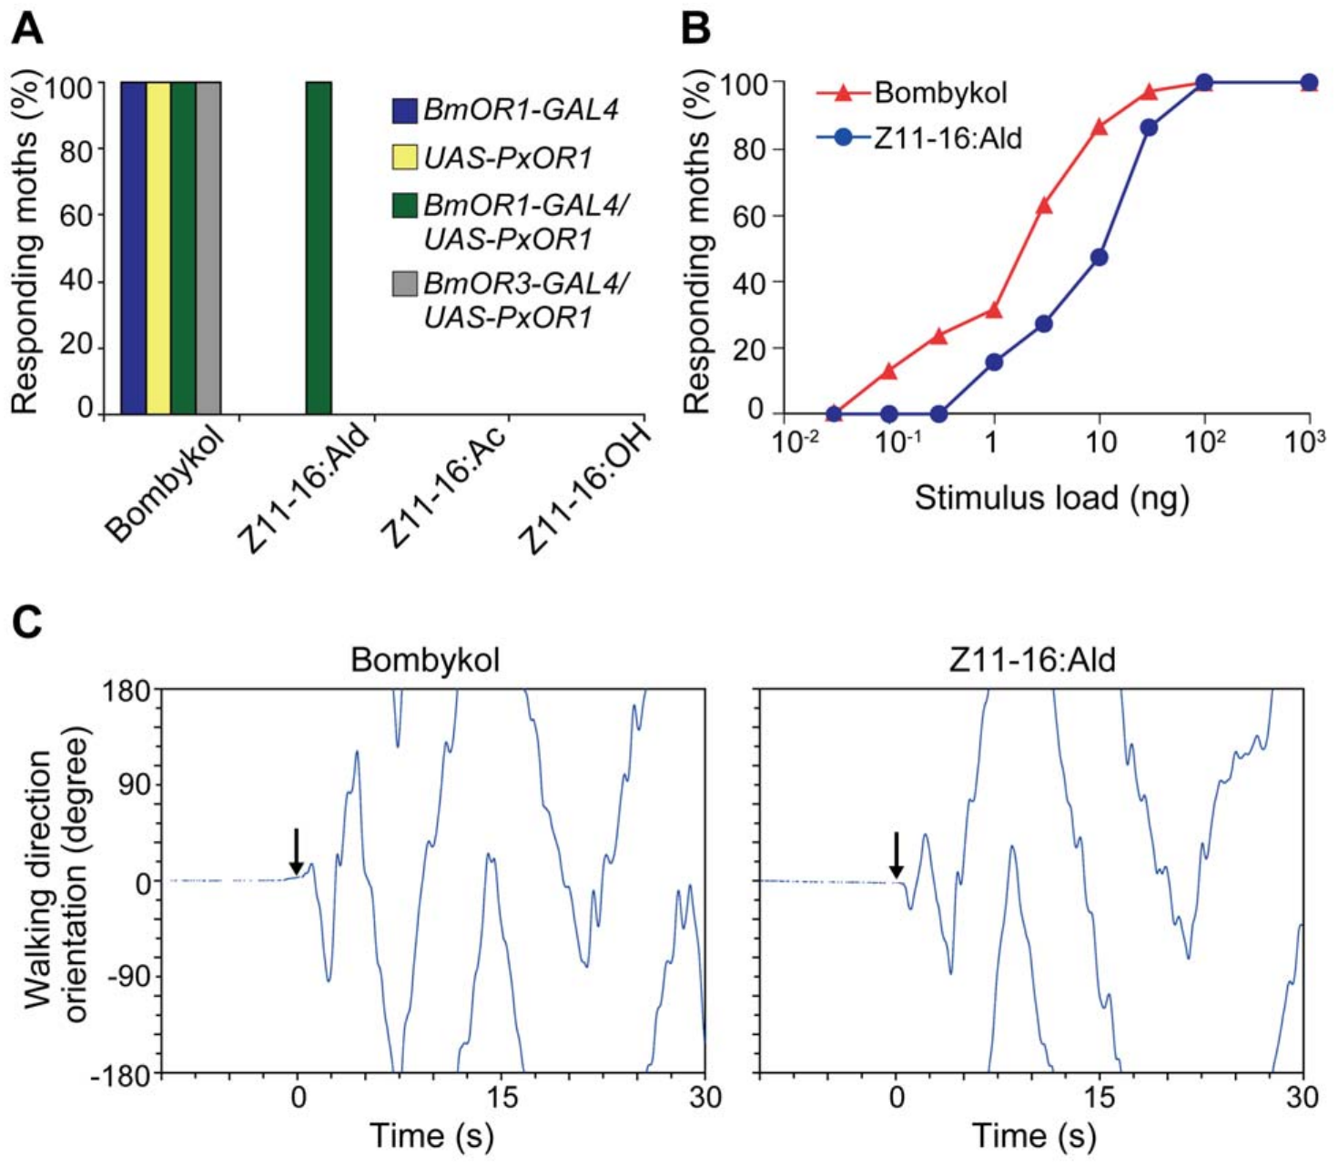
Receptor addition changes mate-search initiation
Sakurai and colleagues tested whether the newly detected aldehyde could activate behavior through the bombykol pathway. Transgenic males expressing PxOR1 in BmOR1 neurons initiated wing flapping and pheromone-search walking in response to Z11-16:Ald. Parental genetic controls did not acquire that response.
Walking trajectories after the new ligand included the characteristic searching sequence. The manipulated males also attempted copulation with diamondback-moth females while retaining responsiveness to bombykol. Chemical recognition was altered without replacing the male’s existing central sensory-to-motor pathway.
The behavioral result connects receptor-neuron activation to initiation of a species-typical program. Activation of the bombykol channel by a new ligand is enough to start wing flapping and search walking, so the identity of the activated channel determines the program.
Sakurai et al. (2011), Fig. 3(A–C). Behavioral responses and walking turns to the newly detected ligand.
Sakurai et al. (2011)
14
Notes:
• Sakurai and colleagues tested whether the newly detected aldehyde could activate behavior through the bombykol pathway. Transgenic males expressing PxOR1 in BmOR1 neurons initiated wing flapping and pheromone-search walking in response to Z11-16:Ald. Parental genetic controls did not acquire that response.
– A copulation attempt is not the same as mating success. The experiment measured elicited behavior and cannot establish reproductive compatibility between the two species.
• Walking trajectories after the new ligand included the characteristic searching sequence. The manipulated males also attempted copulation with diamondback-moth females while retaining responsiveness to bombykol. Chemical recognition was altered without replacing the male’s existing central sensory-to-motor pathway.
• The behavioral result connects receptor-neuron activation to initiation of a species-typical program. Activation of the bombykol channel by a new ligand is enough to start wing flapping and search walking, so the identity of the activated channel determines the program.
References:
Sakurai T, Mitsuno H, Haupt SS, Uchino K, Yokohari F, Nishioka T, Kobayashi I, Sezutsu H, Tamura T, Kanzaki R (2011). A Single Sex Pheromone Receptor Determines Chemical Response Specificity of Sexual Behavior in the Silkmoth Bombyx mori. PLoS Genetics 7(6):e1002115. https://doi.org/10.1371/journal.pgen.1002115
Figure: Sakurai et al. (2011), Fig. 3(A–C). Behavioral responses and walking turns to the newly detected ligand.
Figure source: https://doi.org/10.1371/journal.pgen.1002115

Slide 20
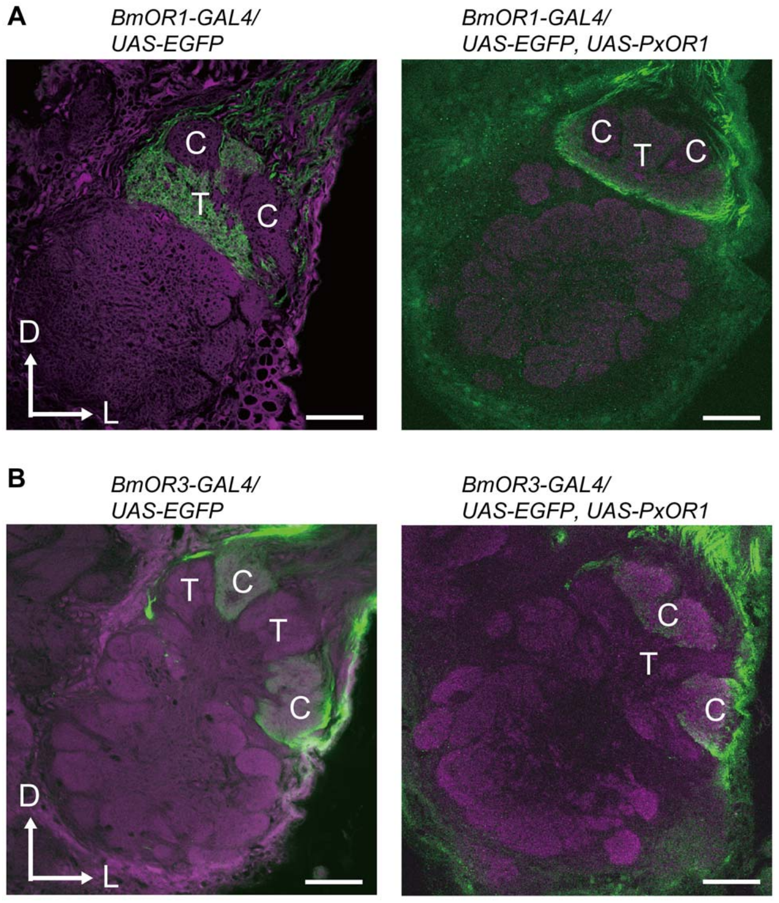
Receptor addition preserves central axon targets
A glomerulus is a region of concentrated sensory terminals and their interacting central neurons. The male silkmoth macroglomerular complex, or MGC, contains enlarged pheromone-processing glomeruli. BmOR1 sensory axons terminate in the toroid, a glomerulus dedicated to bombykol input.
Sakurai and colleagues compared fluorescently labeled axon terminals before and after PxOR1 addition. Axons carrying the modified chemical response still innervated the toroid rather than shifting to the neighboring cumulus. The new ligand therefore entered an existing central channel.
Preserved targeting supports an interpretation in which a changed peripheral detector gains access to established behavioral wiring. Axons from the modified neurons stay in the toroid, so a new ligand is routed to the glomerulus dedicated to bombykol.
Sakurai et al. (2011), Fig. 4(A–B). Sensory axons maintain glomerular targets after receptor addition.
Sakurai et al. (2011)
15
Notes:
• A glomerulus is a region of concentrated sensory terminals and their interacting central neurons. The male silkmoth macroglomerular complex, or MGC, contains enlarged pheromone-processing glomeruli. BmOR1 sensory axons terminate in the toroid, a glomerulus dedicated to bombykol input.
– The toroid is a central target, whereas the receptor resides in the peripheral neuron. Preserving the target separates a change in ligand recognition from a wholesale remapping of sensory axons.
• Sakurai and colleagues compared fluorescently labeled axon terminals before and after PxOR1 addition. Axons carrying the modified chemical response still innervated the toroid rather than shifting to the neighboring cumulus. The new ligand therefore entered an existing central channel.
• Preserved targeting supports an interpretation in which a changed peripheral detector gains access to established behavioral wiring. Axons from the modified neurons stay in the toroid, so a new ligand is routed to the glomerulus dedicated to bombykol.
References:
Sakurai T, Mitsuno H, Haupt SS, Uchino K, Yokohari F, Nishioka T, Kobayashi I, Sezutsu H, Tamura T, Kanzaki R (2011). A Single Sex Pheromone Receptor Determines Chemical Response Specificity of Sexual Behavior in the Silkmoth Bombyx mori. PLoS Genetics 7(6):e1002115. https://doi.org/10.1371/journal.pgen.1002115
Figure: Sakurai et al. (2011), Fig. 4(A–B). Sensory axons maintain glomerular targets after receptor addition.
Figure source: https://doi.org/10.1371/journal.pgen.1002115

Slide 21
A labeled line keeps one odor channel separate
A labeled line is a pathway in which one class of sensory neurons carries one kind of information to a dedicated central target. In the male silkmoth, BmOR1 sensory axons terminate in the toroid, a glomerulus within the macroglomerular complex dedicated to bombykol input.
Sakurai and colleagues compared fluorescently labeled axon terminals before and after PxOR1 addition. Axons carrying the modified chemical response still innervated the toroid rather than shifting to the neighboring cumulus. The new ligand therefore entered an existing central channel.
A changed peripheral detector gains access to established behavioral wiring. This explains why the transgenic males initiated search walking in response to a chemical that normally does not excite their bombykol pathway.
Sakurai et al. (2011), Fig. 4(A–B). Sensory axons maintain glomerular targets after receptor addition.
Sakurai et al. (2011)
15a
Notes:
• A dedicated pathway allows the brain to interpret an input by its channel.
• Definition.
– A labeled line carries one kind of information from one class of sensory neurons to a dedicated target.
• Silkmoth example.
– BmOR1 sensory axons terminate in the toroid.
– The toroid is a glomerulus within the macroglomerular complex.
• Comparison.
– Labeled axon terminals were compared before and after PxOR1 addition.
• Result.
– Axons with the modified response still innervated the toroid.
– They did not shift to the neighboring cumulus.
• Consequence.
– The new ligand entered an existing central channel.
• Behavior.
– Transgenic males initiated search walking to Z11-16:Ald.
– The existing sensory-to-motor pathway carried the new signal.
• Terms.
– A glomerulus is a region of concentrated sensory terminals and interacting central neurons.
– The cumulus is the neighboring glomerulus.
• Macroglomerular complex.
– The macroglomerular complex contains enlarged pheromone-processing glomeruli in the male.
– The toroid is dedicated to bombykol input.
• Interpretation.
– The changed detector gains access to established behavioral wiring.
References:
Sakurai T, Mitsuno H, Haupt SS, Uchino K, Yokohari F, Nishioka T, Kobayashi I, Sezutsu H, Tamura T, Kanzaki R (2011). A Single Sex Pheromone Receptor Determines Chemical Response Specificity of Sexual Behavior in the Silkmoth Bombyx mori. PLoS Genetics 7(6):e1002115. https://doi.org/10.1371/journal.pgen.1002115

Slide 22
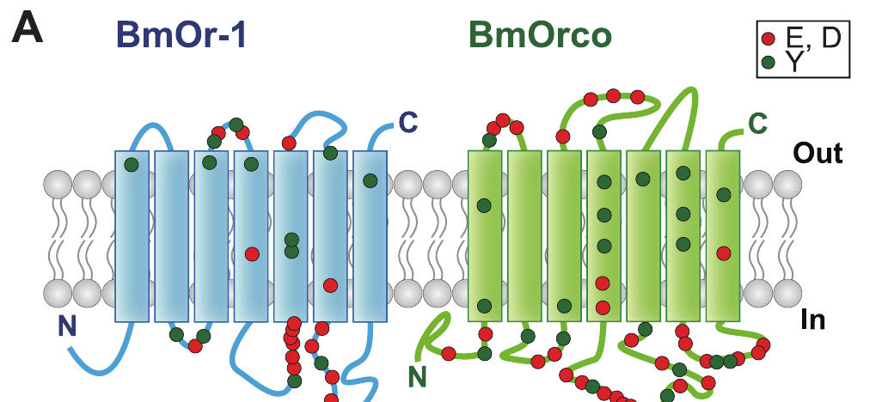
Bombykol receptors require a second subunit
The functional bombykol receptor combines the ligand-selective subunit BmOR1 with Orco, a broadly conserved olfactory co-receptor. A heteromeric complex contains different protein subunits. The older silkmoth name BmOr2 refers to this co-receptor rather than a second bombykol-selective detector.
Sato and colleagues expressed insect receptor pairs in non-insect cells and measured odor-evoked electrical currents. Nakagawa and colleagues then examined the Bombyx pair in frog oocytes using controlled voltage and amino-acid substitutions. Both preparations separate receptor function from an intact moth brain.
The evidence supports a ligand-gated, nonselective cation conductance associated with the receptor complex. Cations are positively charged ions; their movement can change membrane voltage. The BmOR1–Orco complex therefore functions as a heteromeric odor-gated channel in both preparations.
Nakagawa et al. (2012), Fig. 1(A). Published predicted membrane topology and tested receptor residues.
Nakagawa et al. (2012); Sato et al. (2008)
16
Notes:
• The functional bombykol receptor combines the ligand-selective subunit BmOR1 with Orco, a broadly conserved olfactory co-receptor. A heteromeric complex contains different protein subunits. The older silkmoth name BmOr2 refers to this co-receptor rather than a second bombykol-selective detector.
– Ligand recognition and channel function are linked properties of the complex. Heterologous expression tests what the expressed proteins can do without recreating a complete antennal sensillum.
• Sato and colleagues expressed insect receptor pairs in non-insect cells and measured odor-evoked electrical currents. Nakagawa and colleagues then examined the Bombyx pair in frog oocytes using controlled voltage and amino-acid substitutions. Both preparations separate receptor function from an intact moth brain.
• The evidence supports a ligand-gated, nonselective cation conductance associated with the receptor complex. Cations are positively charged ions; their movement can change membrane voltage. The BmOR1–Orco complex therefore functions as a heteromeric odor-gated channel in both preparations.
References:
Nakagawa T, Pellegrino M, Sato K, Vosshall LB, Touhara K (2012). Amino Acid Residues Contributing to Function of the Heteromeric Insect Olfactory Receptor Complex. PLoS ONE 7(3):e32372. https://doi.org/10.1371/journal.pone.0032372
Sato K, Pellegrino M, Nakagawa T, Nakagawa T, Vosshall LB, Touhara K (2008). Insect olfactory receptors are heteromeric ligand-gated ion channels. Nature 452(7190):1002-1006. https://doi.org/10.1038/nature06850
Figure: Nakagawa et al. (2012), Fig. 1(A). Published predicted membrane topology and tested receptor residues.
Figure source: https://doi.org/10.1371/journal.pone.0032372

Slide 23
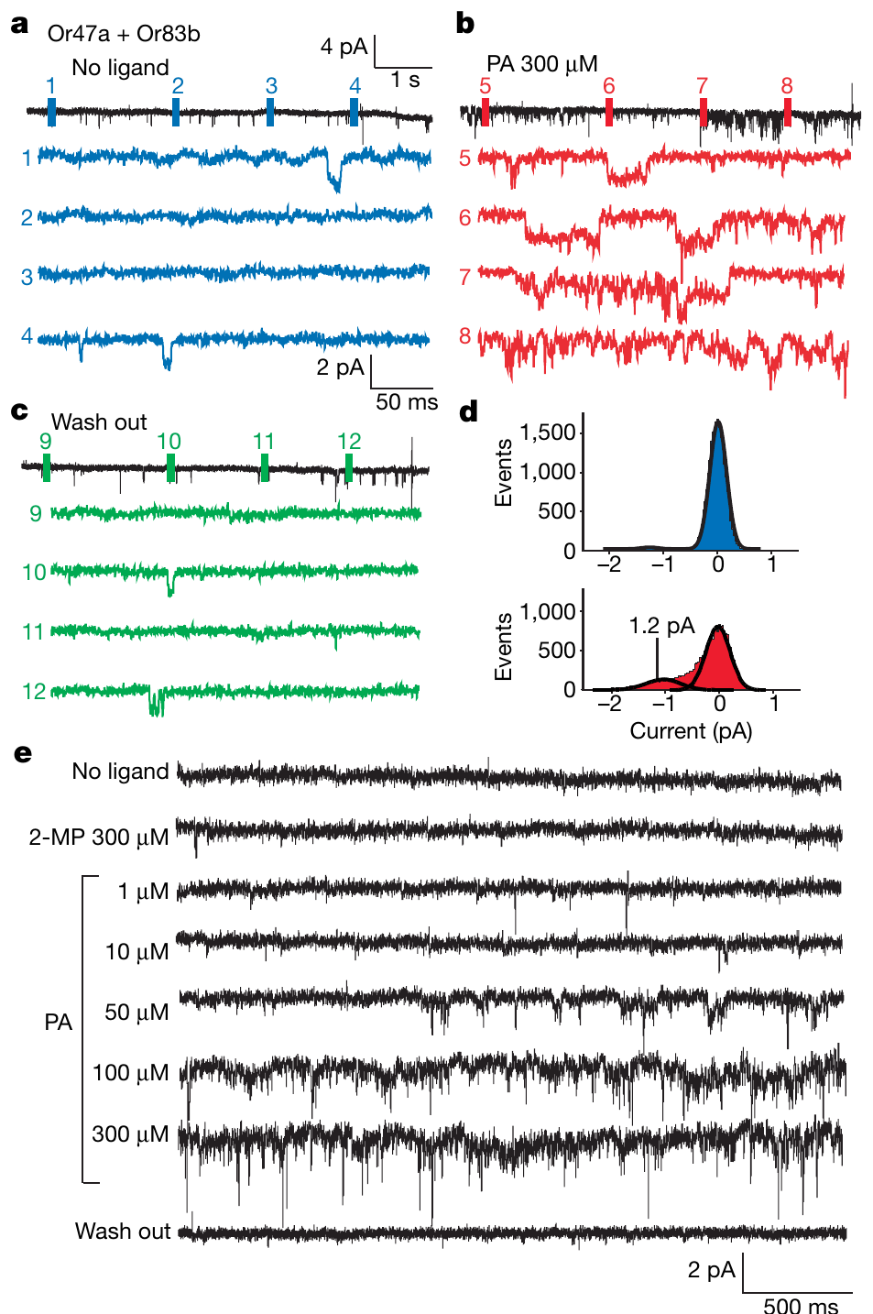
Odor gates current in isolated membrane patches
An outside-out patch is a small piece of membrane removed so its extracellular surface faces the bathing solution. Sato and colleagues recorded odor-evoked openings in patches containing fruitfly Or47a with Or83b, and mosquito receptor complexes. These recordings provide comparative evidence for the insect receptor class.
Pentyl acetate activated the fruitfly complex in excised frog-oocyte patches. At a holding voltage of −80 mV, individual current events were about 1.2 pA. Control oocyte patches without the receptor proteins did not respond to the tested odorants, and activity persisted without added ATP or GTP in the pipette.
Excised-patch activation supports direct odor-gated channel activity without requiring the usual cytoplasmic signaling cascade. Activity persisted without added ATP or GTP, so the receptor complex itself forms the odor-gated channel.
Sato et al. (2008), Fig. 4(a–e). Odor-gated currents in isolated oocyte membrane patches.
Nakagawa et al. (2012), Fig. 1(A). Published predicted membrane topology and tested receptor residues.
Sato et al. (2008); Nakagawa et al. (2012)
17
Notes:
• An outside-out patch is a small piece of membrane removed so its extracellular surface faces the bathing solution. Sato and colleagues recorded odor-evoked openings in patches containing fruitfly Or47a with Or83b, and mosquito receptor complexes. These recordings provide comparative evidence for the insect receptor class.
– A picoampere is one trillionth of an ampere. An opening current is a membrane measurement, whereas neuronal firing additionally depends on the neuron’s voltage-dependent excitability.
• Pentyl acetate activated the fruitfly complex in excised frog-oocyte patches. At a holding voltage of −80 mV, individual current events were about 1.2 pA. Control oocyte patches without the receptor proteins did not respond to the tested odorants, and activity persisted without added ATP or GTP in the pipette.
• Excised-patch activation supports direct odor-gated channel activity without requiring the usual cytoplasmic signaling cascade. Activity persisted without added ATP or GTP, so the receptor complex itself forms the odor-gated channel.
References:
Sato K, Pellegrino M, Nakagawa T, Nakagawa T, Vosshall LB, Touhara K (2008). Insect olfactory receptors are heteromeric ligand-gated ion channels. Nature 452(7190):1002-1006. https://doi.org/10.1038/nature06850
Nakagawa T, Pellegrino M, Sato K, Vosshall LB, Touhara K (2012). Amino Acid Residues Contributing to Function of the Heteromeric Insect Olfactory Receptor Complex. PLoS ONE 7(3):e32372. https://doi.org/10.1371/journal.pone.0032372
Figure: Sato et al. (2008), Fig. 4(a–e). Odor-gated currents in isolated oocyte membrane patches.
Figure source: https://doi.org/10.1038/nature06850
Figure: Nakagawa et al. (2012), Fig. 1(A). Published predicted membrane topology and tested receptor residues.
Figure source: https://doi.org/10.1371/journal.pone.0032372

Slide 24
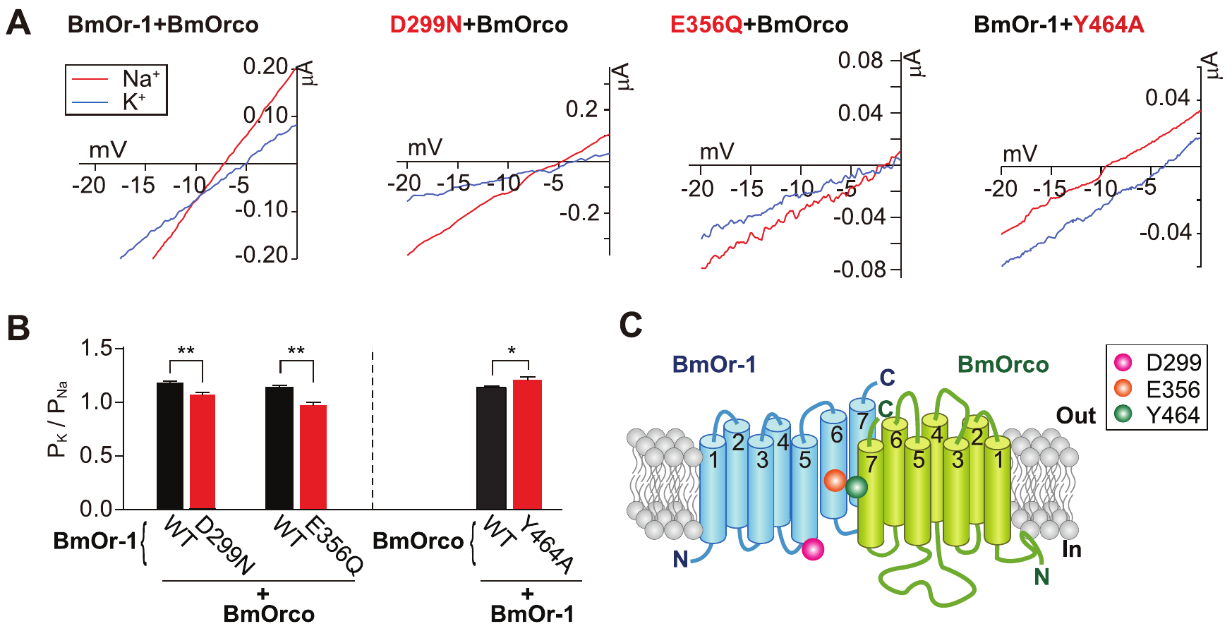
Receptor residues alter cation selectivity
Ion selectivity describes the relative ease with which different ions pass through a channel. Nakagawa and colleagues changed conserved amino acids in the Bombyx BmOR1–Orco complex and recorded bombykol-evoked currents from frog oocytes. Each test changed one subunit while retaining the other in its normal form.
Replacing extracellular sodium with potassium allowed comparison of reversal potentials, the voltage at which net current changes direction. BmOR1 D299N and E356Q reduced relative potassium permeability; Orco Y464A increased it. Thus, substitutions in either protein could affect the ions carried by the complex.
These results implicate both subunits in channel function. The shifts in relative potassium permeability show that residues of BmOR1 and Orco set which cations pass.
Nakagawa et al. (2012), Fig. 2(A–C). Ion-substitution measurements identify selectivity-changing residues.
Nakagawa et al. (2012)
18
Notes:
• Ion selectivity describes the relative ease with which different ions pass through a channel. Nakagawa and colleagues changed conserved amino acids in the Bombyx BmOR1–Orco complex and recorded bombykol-evoked currents from frog oocytes. Each test changed one subunit while retaining the other in its normal form.
– The amino-acid notation identifies the original residue, its position and the replacement. E356Q replaces glutamate at position 356 with glutamine; it does not delete the receptor.
• Replacing extracellular sodium with potassium allowed comparison of reversal potentials, the voltage at which net current changes direction. BmOR1 D299N and E356Q reduced relative potassium permeability; Orco Y464A increased it. Thus, substitutions in either protein could affect the ions carried by the complex.
• These results implicate both subunits in channel function. The shifts in relative potassium permeability show that residues of BmOR1 and Orco set which cations pass.
References:
Nakagawa T, Pellegrino M, Sato K, Vosshall LB, Touhara K (2012). Amino Acid Residues Contributing to Function of the Heteromeric Insect Olfactory Receptor Complex. PLoS ONE 7(3):e32372. https://doi.org/10.1371/journal.pone.0032372
Figure: Nakagawa et al. (2012), Fig. 2(A–C). Ion-substitution measurements identify selectivity-changing residues.
Figure source: https://doi.org/10.1371/journal.pone.0032372

Slide 25
A reversal potential reports which ions pass
A reversal potential is the membrane voltage at which net current changes direction. Its value depends on which ions can cross the channel, so a shift in reversal potential after changing the bathing ions reports a change in ion selectivity.
Nakagawa and colleagues recorded bombykol-evoked currents from frog oocytes expressing the BmOR1–Orco complex. Replacing extracellular sodium with potassium allowed comparison of reversal potentials. BmOR1 D299N and E356Q reduced relative potassium permeability, whereas Orco Y464A increased it.
Substitutions of amino acids in either protein could therefore affect the ions carried by the complex. Each test changed one subunit while retaining the other in its normal form, which implicates both subunits in channel function.
Nakagawa et al. (2012), Fig. 2(A–C). Ion-substitution measurements identify selectivity-changing residues.
Nakagawa et al. (2012)
18a
Notes:
• The reversal potential is a readout of ion selectivity.
• Definition.
– The reversal potential is the voltage at which net current changes direction.
– It depends on which ions cross the channel.
• Preparation.
– BmOR1 and Orco were expressed in frog oocytes.
– Bombykol evoked the currents.
• Ion swap.
– Extracellular sodium was replaced with potassium.
– Reversal potentials were then compared.
• BmOR1 changes.
– D299N and E356Q reduced relative potassium permeability.
• Orco change.
– Y464A increased relative potassium permeability.
• Meaning.
– Each test altered one subunit and kept the other normal.
– Residues in both proteins affect the ions carried by the complex.
• Reading a shift.
– A larger relative potassium permeability moves the reversal potential toward the potassium value.
– A smaller permeability moves it away.
• Preparation.
– Frog oocytes allow receptor function to be studied apart from an intact moth brain.
• Mutation names.
– A name such as D299N shows the original amino acid, its position and the replacement.
– Each substitution changes a single residue.
• Conclusion.
– Both subunits contribute to the channel.
– Residues in either protein affect which ions pass.
References:
Nakagawa T, Pellegrino M, Sato K, Vosshall LB, Touhara K (2012). Amino Acid Residues Contributing to Function of the Heteromeric Insect Olfactory Receptor Complex. PLoS ONE 7(3):e32372. https://doi.org/10.1371/journal.pone.0032372

Slide 26
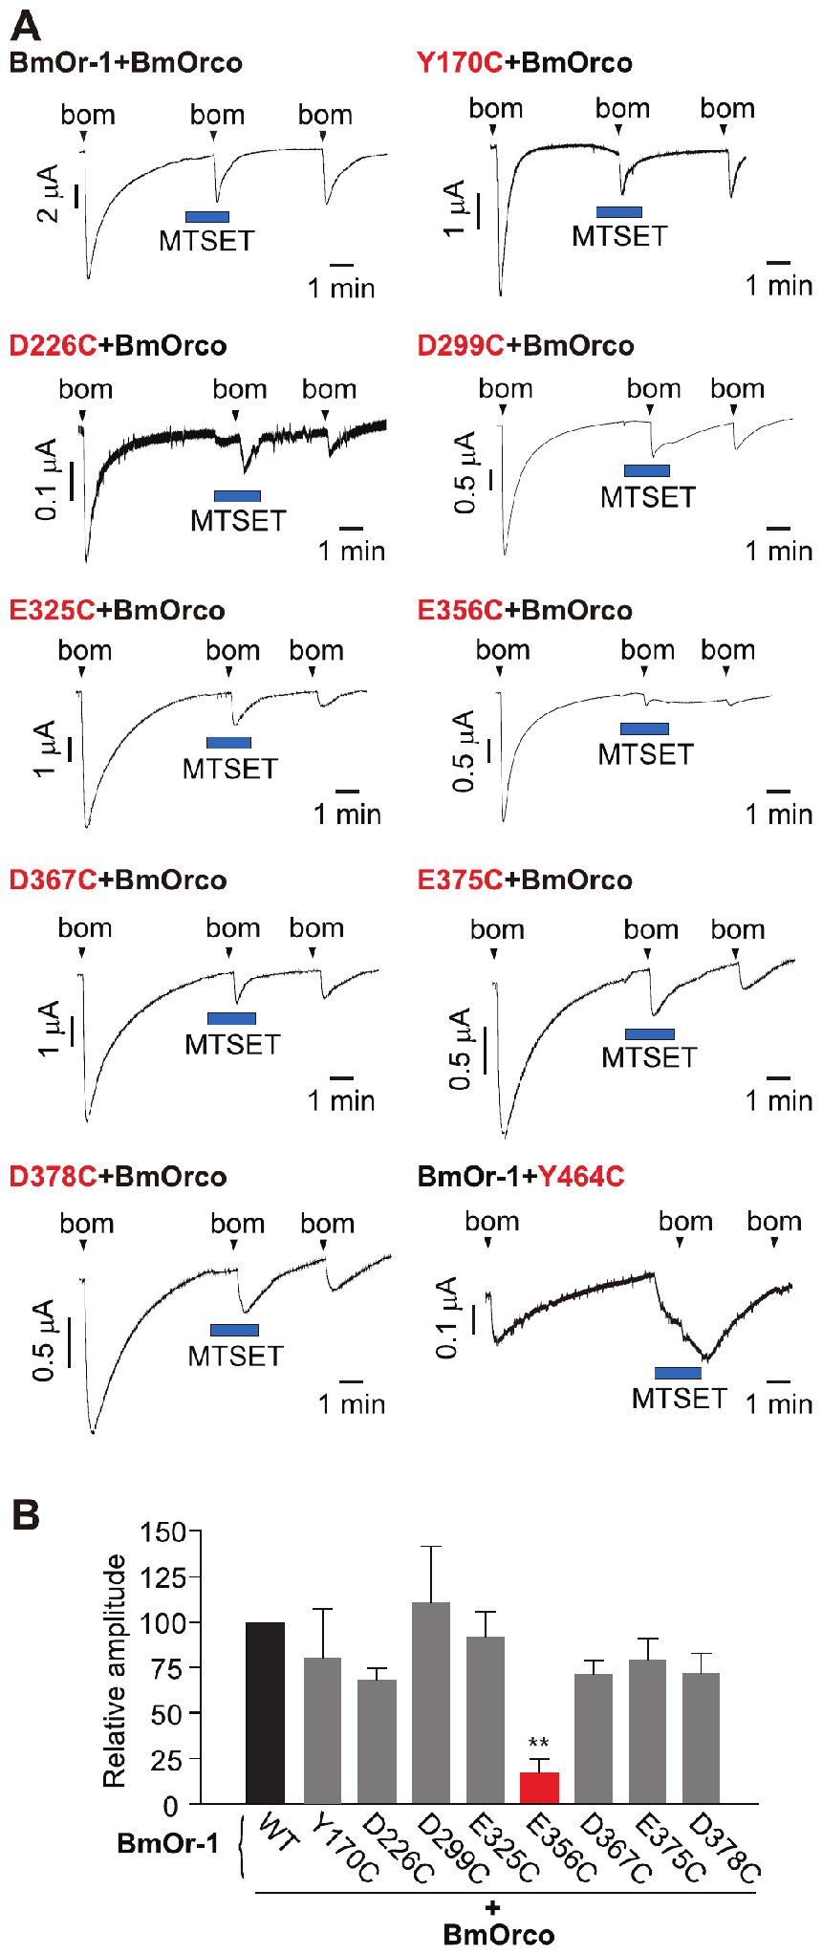
Chemical modification probes receptor function
Nakagawa and colleagues replaced selected receptor residues with cysteine, an amino acid whose exposed chemical group can react with a modifying reagent. They applied MTSET, a cysteine-reactive compound, while recording bombykol currents from oocytes expressing the modified receptor pair.
BmOR1 E356C currents were strongly and irreversibly inhibited by MTSET. Orco Y464C instead produced a rapid inward current during reagent application. The mutants retained bombykol dose-response sensitivity similar to the normal complex, helping separate ligand recognition from the altered modification response.
These interventions support accessibility and functional importance of specific residues near the proteins’ carboxy-terminal regions. Mutants retained bombykol dose-response sensitivity, so the modification alters channel function and not ligand recognition.
Nakagawa et al. (2012), Fig. 3(A–B). Cysteine substitution and chemical modification probe channel function.
Nakagawa et al. (2012)
19
Notes:
• Nakagawa and colleagues replaced selected receptor residues with cysteine, an amino acid whose exposed chemical group can react with a modifying reagent. They applied MTSET, a cysteine-reactive compound, while recording bombykol currents from oocytes expressing the modified receptor pair.
– Chemical accessibility means a reagent can reach a reactive group under the experimental conditions. Accessibility and altered current constrain channel hypotheses without establishing the complete three-dimensional structure.
• BmOR1 E356C currents were strongly and irreversibly inhibited by MTSET. Orco Y464C instead produced a rapid inward current during reagent application. The mutants retained bombykol dose-response sensitivity similar to the normal complex, helping separate ligand recognition from the altered modification response.
• These interventions support accessibility and functional importance of specific residues near the proteins’ carboxy-terminal regions. Mutants retained bombykol dose-response sensitivity, so the modification alters channel function and not ligand recognition.
References:
Nakagawa T, Pellegrino M, Sato K, Vosshall LB, Touhara K (2012). Amino Acid Residues Contributing to Function of the Heteromeric Insect Olfactory Receptor Complex. PLoS ONE 7(3):e32372. https://doi.org/10.1371/journal.pone.0032372
Figure: Nakagawa et al. (2012), Fig. 3(A–B). Cysteine substitution and chemical modification probe channel function.
Figure source: https://doi.org/10.1371/journal.pone.0032372

Slide 27
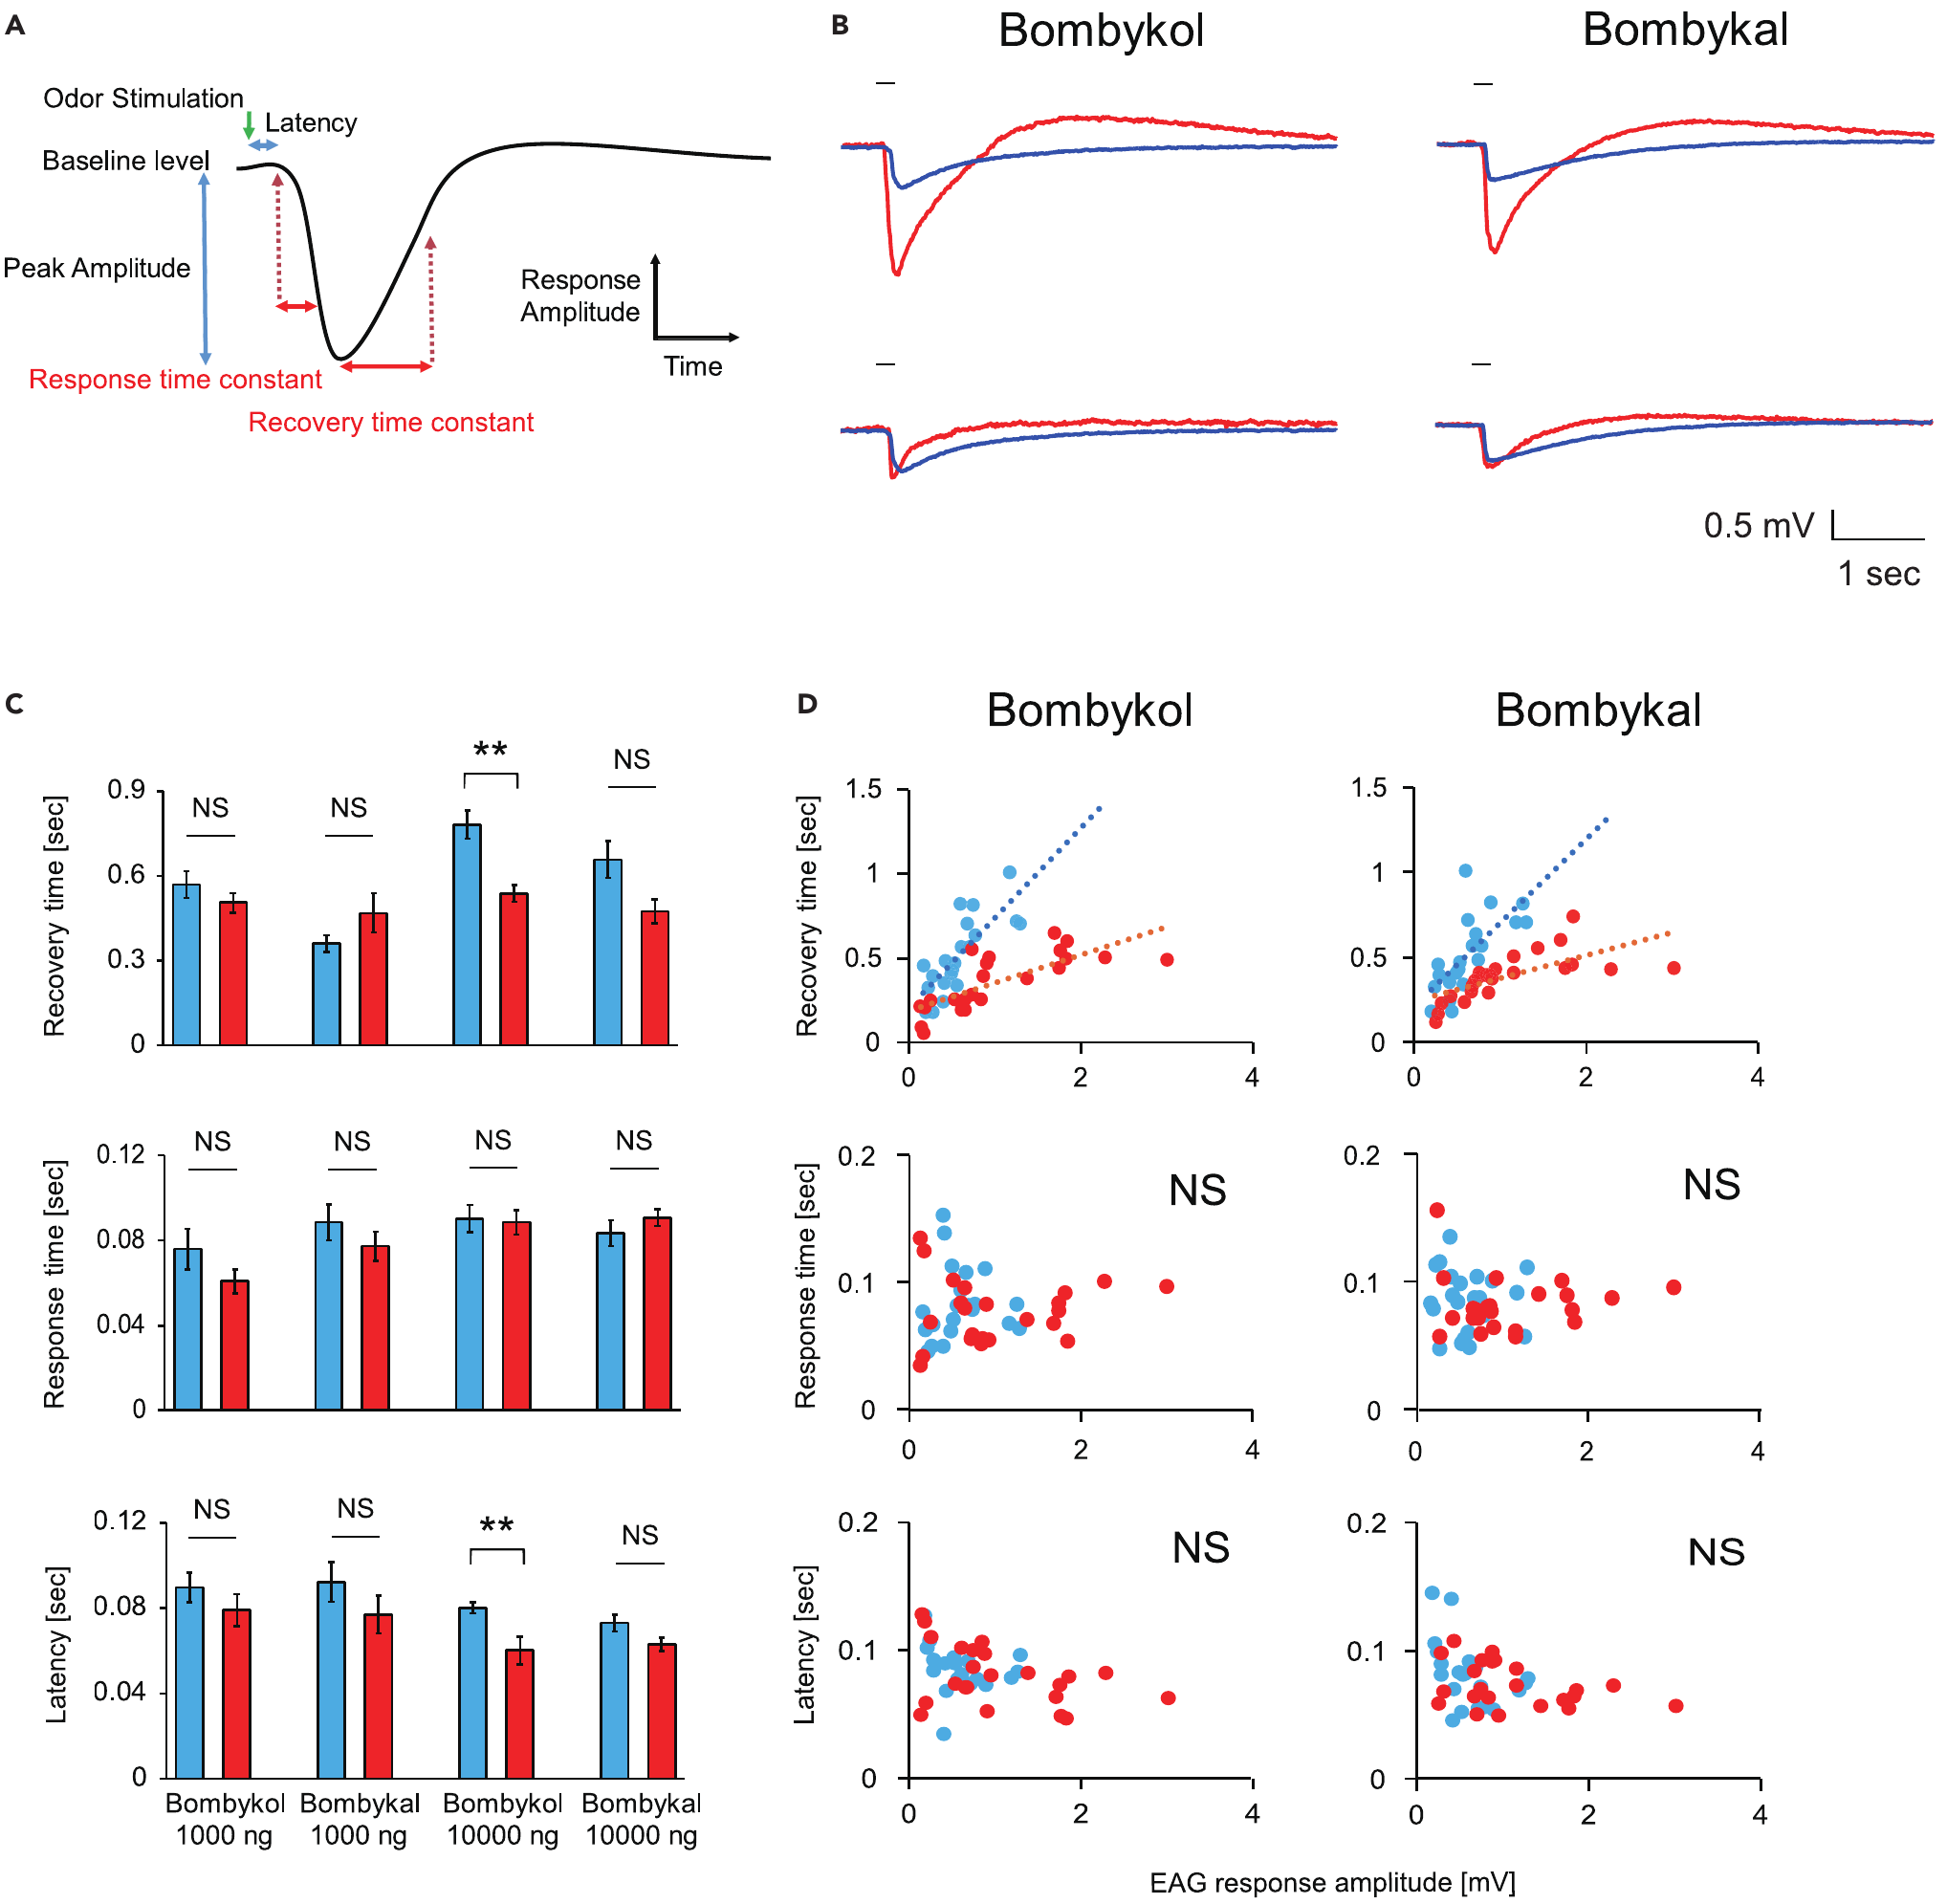
A binding protein shapes response termination
Pheromone-binding protein, or PBP, is a soluble protein in the fluid surrounding sensory endings inside an antennal sensillum. Shiota and colleagues deleted BmPBP1 and tested whether its contribution extended beyond increasing sensitivity. Antennal recordings measured the rise and recovery of responses to 200-ms odor pulses.
The knockout antennae remained responsive but produced smaller EAG peaks at the same dose. The investigators therefore compared kinetics while accounting for response amplitude. After that control, knockout responses recovered more slowly, whereas response rise and onset latency did not differ in the same way.
BmPBP1 contributes to termination of the peripheral response as well as detection sensitivity. Slower recovery with preserved onset latency places the protein's role at the end of the response, when stimulation of the receptor must stop.
Shiota et al. (2021), Fig. 1(A–D). Antennal response kinetics after pheromone-binding-protein loss.
Sakurai et al. (2011), Fig. 1(A–D). Receptor expression and sensory-cell localization in the antenna.
Shiota et al. (2021); Sakurai et al. (2011)
20
Notes:
• Pheromone-binding protein, or PBP, is a soluble protein in the fluid surrounding sensory endings inside an antennal sensillum. Shiota and colleagues deleted BmPBP1 and tested whether its contribution extended beyond increasing sensitivity. Antennal recordings measured the rise and recovery of responses to 200-ms odor pulses.
– A recovery time constant describes how quickly the response approaches baseline. Delayed recovery can blur closely spaced inputs even when the initial odor remains detectable.
• The knockout antennae remained responsive but produced smaller EAG peaks at the same dose. The investigators therefore compared kinetics while accounting for response amplitude. After that control, knockout responses recovered more slowly, whereas response rise and onset latency did not differ in the same way.
• BmPBP1 contributes to termination of the peripheral response as well as detection sensitivity. Slower recovery with preserved onset latency places the protein's role at the end of the response, when stimulation of the receptor must stop.
References:
Shiota Y, Sakurai T, Ando N, Haupt SS, Mitsuno H, Daimon T, Kanzaki R (2021). Pheromone binding protein is involved in temporal olfactory resolution in the silkmoth. iScience 24(11):103334. https://doi.org/10.1016/j.isci.2021.103334
Sakurai T, Mitsuno H, Haupt SS, Uchino K, Yokohari F, Nishioka T, Kobayashi I, Sezutsu H, Tamura T, Kanzaki R (2011). A Single Sex Pheromone Receptor Determines Chemical Response Specificity of Sexual Behavior in the Silkmoth Bombyx mori. PLoS Genetics 7(6):e1002115. https://doi.org/10.1371/journal.pgen.1002115
Figure: Shiota et al. (2021), Fig. 1(A–D). Antennal response kinetics after pheromone-binding-protein loss.
Figure source: https://doi.org/10.1016/j.isci.2021.103334
Figure: Sakurai et al. (2011), Fig. 1(A–D). Receptor expression and sensory-cell localization in the antenna.
Figure source: https://doi.org/10.1371/journal.pgen.1002115

Slide 28
A knockout removes a gene to reveal its function
A knockout is an animal in which a specific gene has been deleted, so the protein it encodes is absent. Comparing knockout and normal animals reveals what the protein contributes to a response.
Shiota and colleagues deleted BmPBP1, the pheromone-binding protein in the fluid around sensory endings. Antennal recordings measured the rise and recovery of responses to 200-ms odor pulses. The knockout antennae remained responsive but produced smaller EAG peaks at the same dose.
Because amplitude differed, the investigators compared kinetics while accounting for response amplitude. After that control, knockout responses recovered more slowly, whereas rise and onset latency did not differ in the same way, which assigns the protein a role in terminating the response.
Shiota et al. (2021), Fig. 1(A–D). Antennal response kinetics after pheromone-binding-protein loss.
Sakurai et al. (2011), Fig. 1(A–D). Receptor expression and sensory-cell localization in the antenna.
Shiota et al. (2021); Sakurai et al. (2011)
20a
Notes:
• Deleting a gene tests what its protein normally does.
• Definition.
– A knockout lacks a specific gene.
– The protein it encodes is absent.
• Target.
– BmPBP1 is the pheromone-binding protein in the fluid around sensory endings.
• Recording.
– Antennal recordings measured the rise and recovery of responses.
– Odor pulses lasted 200 milliseconds.
• Amplitude.
– Knockout antennae remained responsive.
– They produced smaller EAG peaks at the same dose.
• Control.
– Kinetics were compared while accounting for response amplitude.
• Result.
– Knockout responses recovered more slowly.
– Rise and onset latency did not differ in the same way.
• Why compare kinetics.
– A smaller peak alone could look like slower recovery.
– Matching for amplitude removes that confusion.
• Role of the protein.
– BmPBP1 contributes to termination of the peripheral response as well as detection sensitivity.
• Fluid around the endings.
– PBP is a soluble protein in the fluid surrounding sensory endings inside an antennal sensillum.
– The knockout deletes this protein.
• Consequence.
– Slower termination of the peripheral response affects how successive pulses are separated.
References:
Shiota Y, Sakurai T, Ando N, Haupt SS, Mitsuno H, Daimon T, Kanzaki R (2021). Pheromone binding protein is involved in temporal olfactory resolution in the silkmoth. iScience 24(11):103334. https://doi.org/10.1016/j.isci.2021.103334
Sakurai T, Mitsuno H, Haupt SS, Uchino K, Yokohari F, Nishioka T, Kobayashi I, Sezutsu H, Tamura T, Kanzaki R (2011). A Single Sex Pheromone Receptor Determines Chemical Response Specificity of Sexual Behavior in the Silkmoth Bombyx mori. PLoS Genetics 7(6):e1002115. https://doi.org/10.1371/journal.pgen.1002115

Slide 29
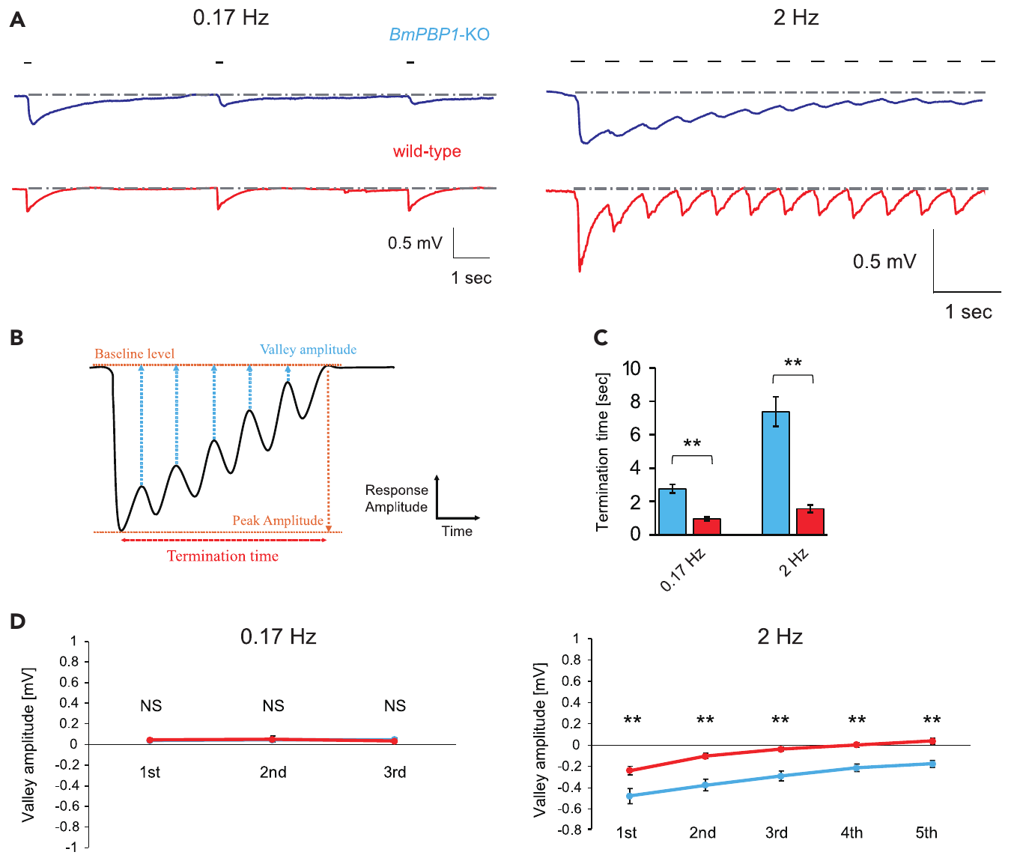
Matched responses reveal slower peripheral recovery
An amplitude difference can confound comparisons of sensory timing. Shiota and colleagues used 100 ng of bombykol for normal antennae and 10,000 ng for knockout antennae when comparing EAG pulse-train responses. These source loads were chosen to compensate for the lower knockout sensitivity.
At 0.17 Hz, both groups recovered between pulses, although termination was slower in mutants. At 2 Hz, several knockout preparations never returned to baseline throughout the train, whereas normal antennae recovered rapidly. The remaining voltage between responses was larger in the knockout.
The defect therefore concerns separation of successive encounters rather than complete sensory failure. With 100 ng and 10,000 ng source loads, knockout antennae still recovered more slowly at 2 Hz, so amplitude matching strengthens the timing interpretation.
Shiota et al. (2021), Fig. 2(A–D). Antennal recovery to 0.17-Hz and 2-Hz pheromone pulse trains.
Sakurai et al. (2011), Fig. 1(A–D). Receptor expression and sensory-cell localization in the antenna.
Shiota et al. (2021); Sakurai et al. (2011)
21
Notes:
• An amplitude difference can confound comparisons of sensory timing. Shiota and colleagues used 100 ng of bombykol for normal antennae and 10,000 ng for knockout antennae when comparing EAG pulse-train responses. These source loads were chosen to compensate for the lower knockout sensitivity.
– Hertz means events per second. The 2-Hz treatment tests repeated contact at a rate that can sustain consecutive surges, whereas the lower rate permits longer gaps.
• At 0.17 Hz, both groups recovered between pulses, although termination was slower in mutants. At 2 Hz, several knockout preparations never returned to baseline throughout the train, whereas normal antennae recovered rapidly. The remaining voltage between responses was larger in the knockout.
• The defect therefore concerns separation of successive encounters rather than complete sensory failure. With 100 ng and 10,000 ng source loads, knockout antennae still recovered more slowly at 2 Hz, so amplitude matching strengthens the timing interpretation.
References:
Shiota Y, Sakurai T, Ando N, Haupt SS, Mitsuno H, Daimon T, Kanzaki R (2021). Pheromone binding protein is involved in temporal olfactory resolution in the silkmoth. iScience 24(11):103334. https://doi.org/10.1016/j.isci.2021.103334
Sakurai T, Mitsuno H, Haupt SS, Uchino K, Yokohari F, Nishioka T, Kobayashi I, Sezutsu H, Tamura T, Kanzaki R (2011). A Single Sex Pheromone Receptor Determines Chemical Response Specificity of Sexual Behavior in the Silkmoth Bombyx mori. PLoS Genetics 7(6):e1002115. https://doi.org/10.1371/journal.pgen.1002115
Figure: Shiota et al. (2021), Fig. 2(A–D). Antennal recovery to 0.17-Hz and 2-Hz pheromone pulse trains.
Figure source: https://doi.org/10.1016/j.isci.2021.103334
Figure: Sakurai et al. (2011), Fig. 1(A–D). Receptor expression and sensory-cell localization in the antenna.
Figure source: https://doi.org/10.1371/journal.pgen.1002115

Slide 30
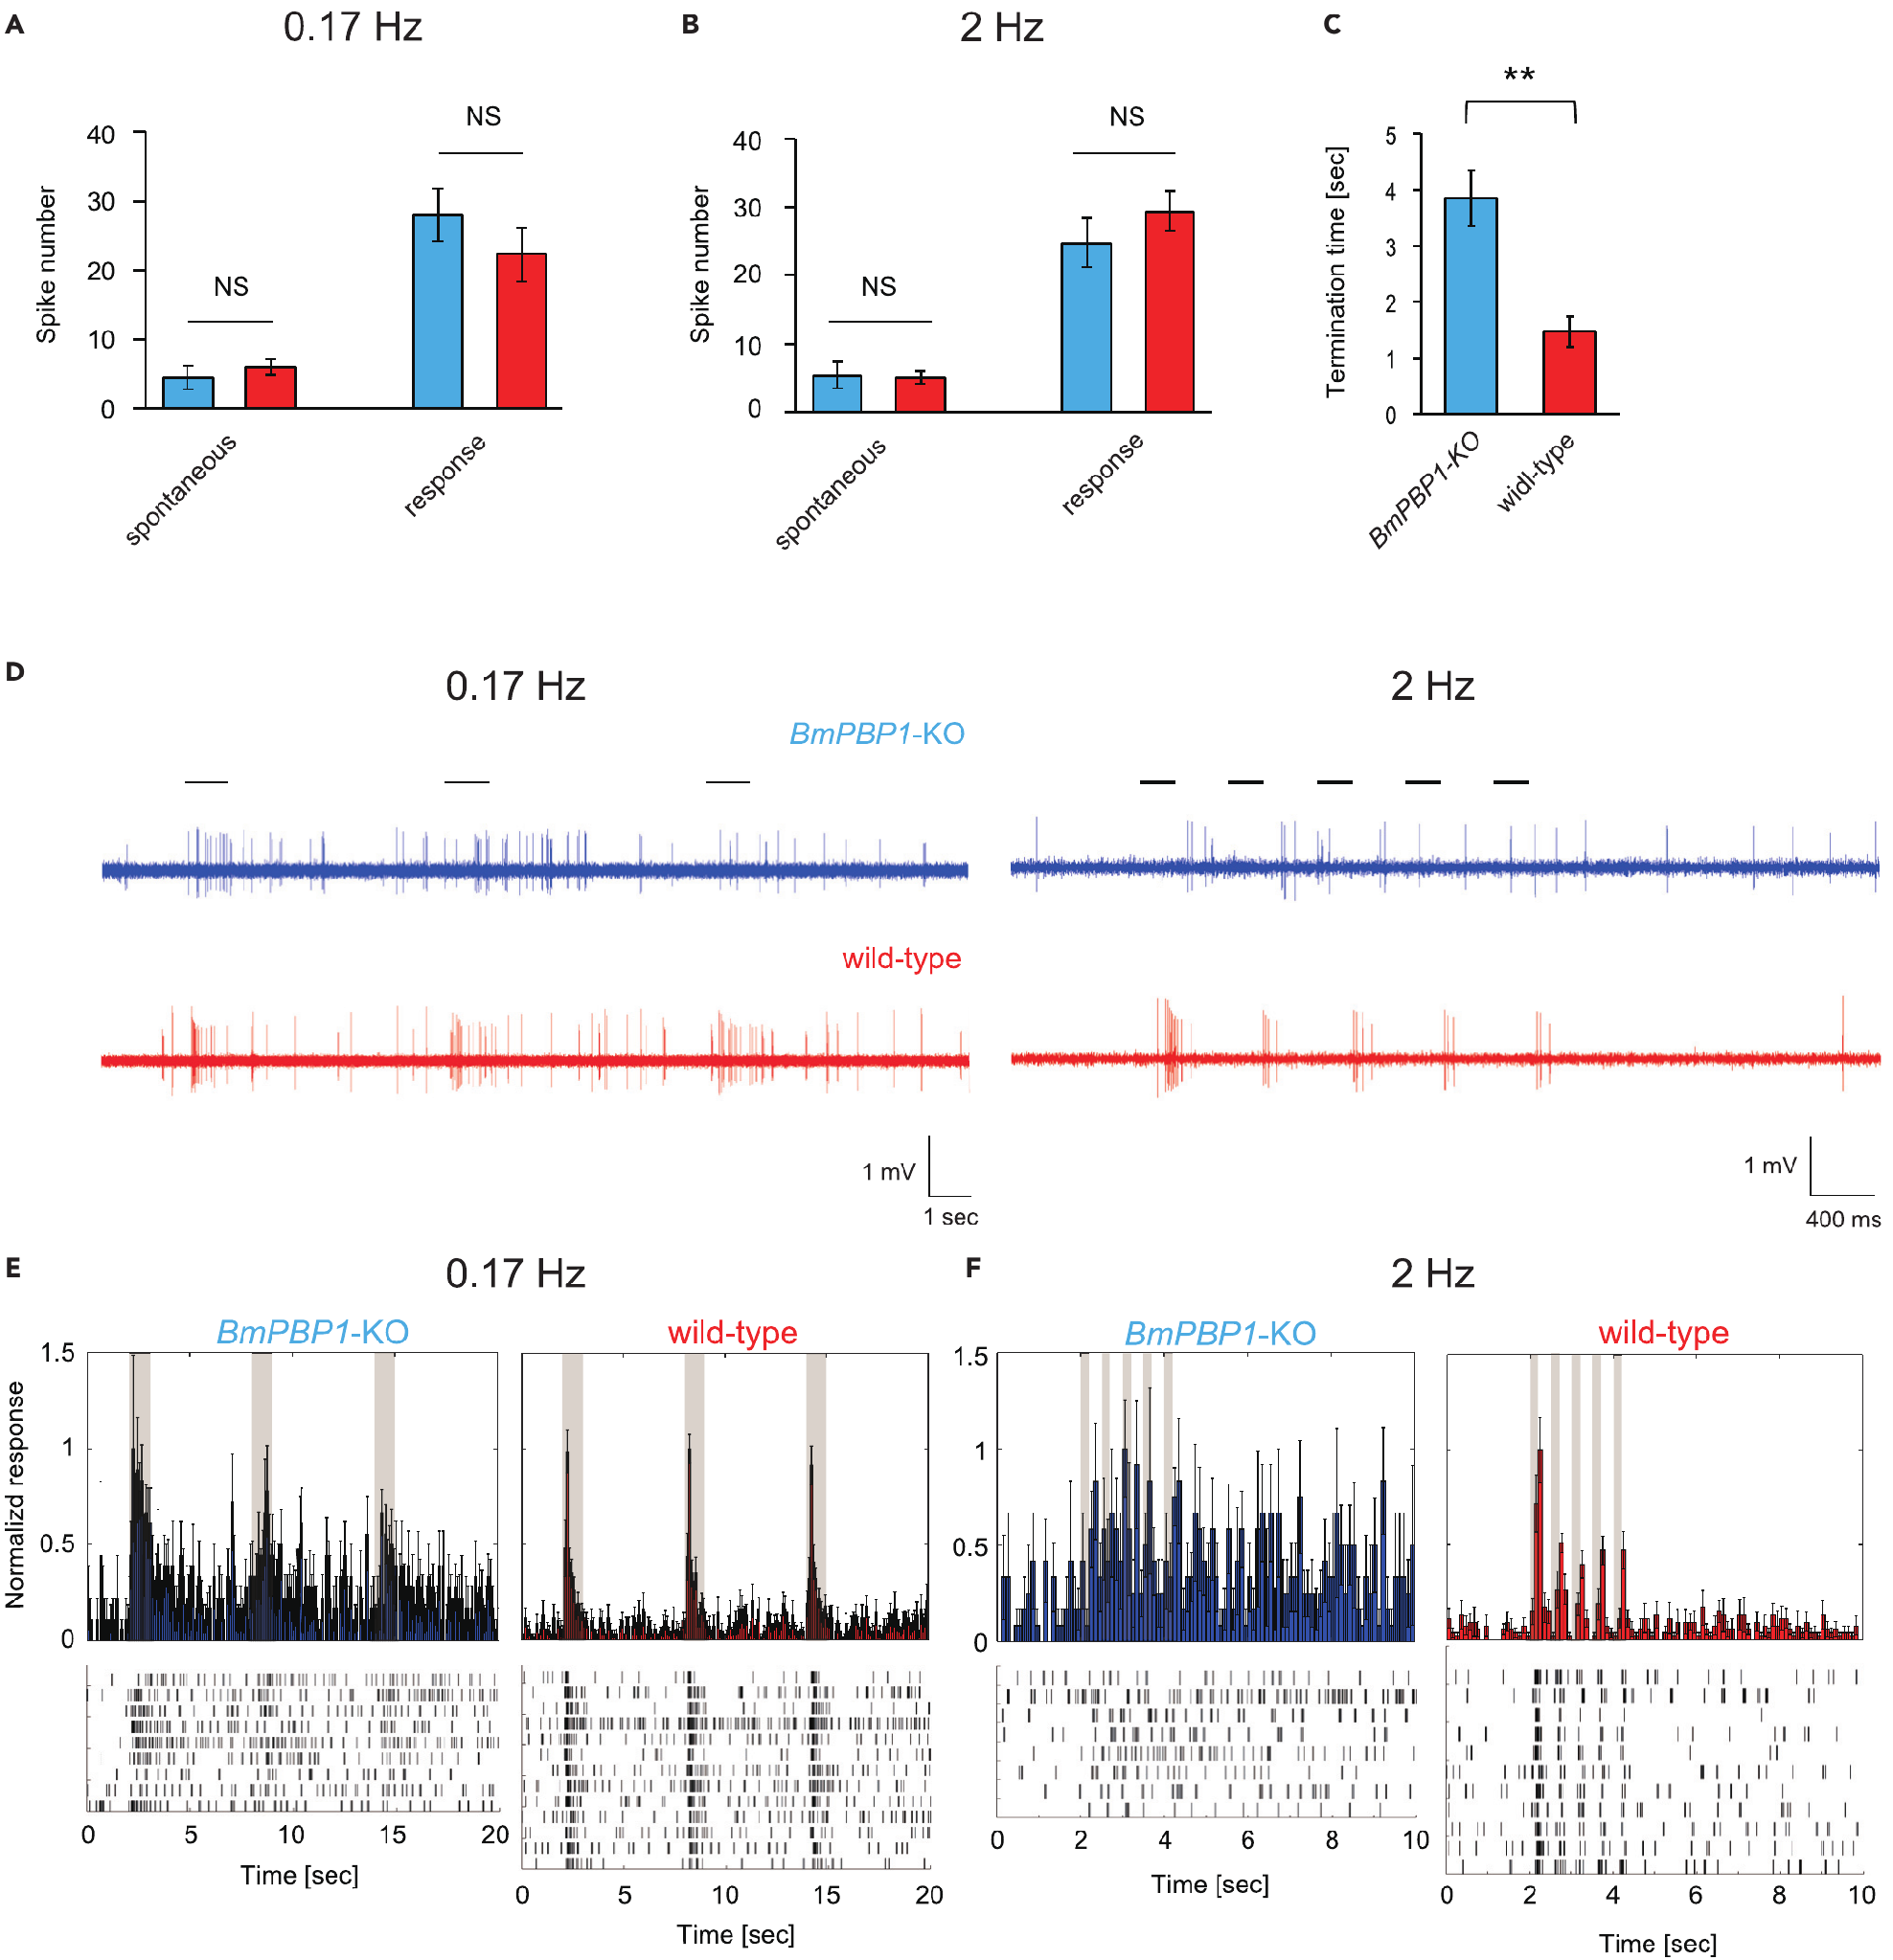
Sensory neurons must separate successive pulses
Shiota and colleagues tested individual bombykol-responsive neurons with single-sensillum recordings. They compared normal and BmPBP1-knockout antennae using 1,000 and 10,000 ng source loads, respectively. Similar evoked spike totals reduced the possibility that response-strength differences alone explained altered timing.
Spontaneous firing was similar between groups. After isolated stimulation at 0.17 Hz, knockout firing took longer to return to its spontaneous level. At 2 Hz, all tested knockout neurons remained above spontaneous activity between successive stimuli, whereas normal responses terminated rapidly.
An action potential, or spike, is a brief regenerative electrical event transmitted along an axon. Prolonged spike output can obscure the boundary between separate odor contacts. Elevated firing between pulses at 2 Hz in every tested knockout neuron links the EAG recovery defect to sensory-neuron activity.
Shiota et al. (2021), Fig. 3(A–F). Single-neuron response termination under amplitude-matched stimulation.
Sakurai et al. (2011), Fig. 1(A–D). Receptor expression and sensory-cell localization in the antenna.
Shiota et al. (2021); Sakurai et al. (2011)
22
Notes:
• Shiota and colleagues tested individual bombykol-responsive neurons with single-sensillum recordings. They compared normal and BmPBP1-knockout antennae using 1,000 and 10,000 ng source loads, respectively. Similar evoked spike totals reduced the possibility that response-strength differences alone explained altered timing.
– Similar total spike counts can conceal very different temporal patterns. A persistent response and a short burst may transmit equal counts while carrying different information about odor onset.
• Spontaneous firing was similar between groups. After isolated stimulation at 0.17 Hz, knockout firing took longer to return to its spontaneous level. At 2 Hz, all tested knockout neurons remained above spontaneous activity between successive stimuli, whereas normal responses terminated rapidly.
• An action potential, or spike, is a brief regenerative electrical event transmitted along an axon. Prolonged spike output can obscure the boundary between separate odor contacts. Elevated firing between pulses at 2 Hz in every tested knockout neuron links the EAG recovery defect to sensory-neuron activity.
References:
Shiota Y, Sakurai T, Ando N, Haupt SS, Mitsuno H, Daimon T, Kanzaki R (2021). Pheromone binding protein is involved in temporal olfactory resolution in the silkmoth. iScience 24(11):103334. https://doi.org/10.1016/j.isci.2021.103334
Sakurai T, Mitsuno H, Haupt SS, Uchino K, Yokohari F, Nishioka T, Kobayashi I, Sezutsu H, Tamura T, Kanzaki R (2011). A Single Sex Pheromone Receptor Determines Chemical Response Specificity of Sexual Behavior in the Silkmoth Bombyx mori. PLoS Genetics 7(6):e1002115. https://doi.org/10.1371/journal.pgen.1002115
Figure: Shiota et al. (2021), Fig. 3(A–F). Single-neuron response termination under amplitude-matched stimulation.
Figure source: https://doi.org/10.1016/j.isci.2021.103334
Figure: Sakurai et al. (2011), Fig. 1(A–D). Receptor expression and sensory-cell localization in the antenna.
Figure source: https://doi.org/10.1371/journal.pgen.1002115

Slide 31
Slow termination changes the surge–turn sequence
Peripheral timing can change how searching behavior resets after a pheromone contact. The surge is the forward search phase that follows a contact, and the zigzag is the turning phase that follows it. Shiota and colleagues measured the body angle of tethered males during isolated and repeated bombykol exposure. Knockouts kept the complete surge–zigzag sequence after a single pulse, but their initial surge lasted longer than in normal males.
At 0.17 Hz, successive contacts restarted surges in both groups. At 0.83 and 2 Hz, knockouts showed fewer surges and more zigzag turning, and during the 2-Hz train they produced fewer surges lasting more than 2 s. The prolonged response to a single stimulus therefore did not carry over into sustained forward progress under repeated contact. These differences appear only when the stimuli arrive repeatedly, so the duration of the sensory response matters most under sustained contact.
Repeated stimulation requires each new contact to separate from the previous one, so the sensory response must end before the next pheromone pulse arrives. Surge rate and zigzag turning at 0.83 and 2 Hz track how well successive onsets are separated, and slow termination of the sensory neuron blurs that separation. Each surge therefore requires a clean reset of the sensory input before the next contact can drive it.
Shiota et al. (2021), Fig. 4(A–E). Surge and turning behavior after pheromone-binding-protein loss.
Shiota et al. (2021)
23
Notes:
• Peripheral timing can affect the reset of searching behavior. Shiota and colleagues measured tethered males’ body angle during isolated and repeated bombykol exposure. Knockouts retained the complete surge–zigzag sequence after a single pulse, but their initial surge lasted longer than in normal males.
– Surge rate here is the fraction of locomotion time spent surging. It differs from the frequency of presented odor pulses and from the speed of an individual forward movement.
• At 0.17 Hz, successive contacts restarted surges in both groups. At 0.83 and 2 Hz, knockouts had lower surge rates and more zigzag turning. They also produced fewer surges lasting more than 2 s during the 2-Hz train, despite the prolonged response to an isolated stimulus.
• A longer sensory response does not necessarily produce more sustained forward progress under repeated stimulation. The authors proposed that poor separation of onsets prevents efficient resetting. Surge rate and zigzag turning at 0.83 and 2 Hz therefore track how well successive onsets are separated by the sensory neuron.
References:
Shiota Y, Sakurai T, Ando N, Haupt SS, Mitsuno H, Daimon T, Kanzaki R (2021). Pheromone binding protein is involved in temporal olfactory resolution in the silkmoth. iScience 24(11):103334. https://doi.org/10.1016/j.isci.2021.103334
Figure: Shiota et al. (2021), Fig. 4(A–E). Surge and turning behavior after pheromone-binding-protein loss.
Figure source: https://doi.org/10.1016/j.isci.2021.103334

Slide 32
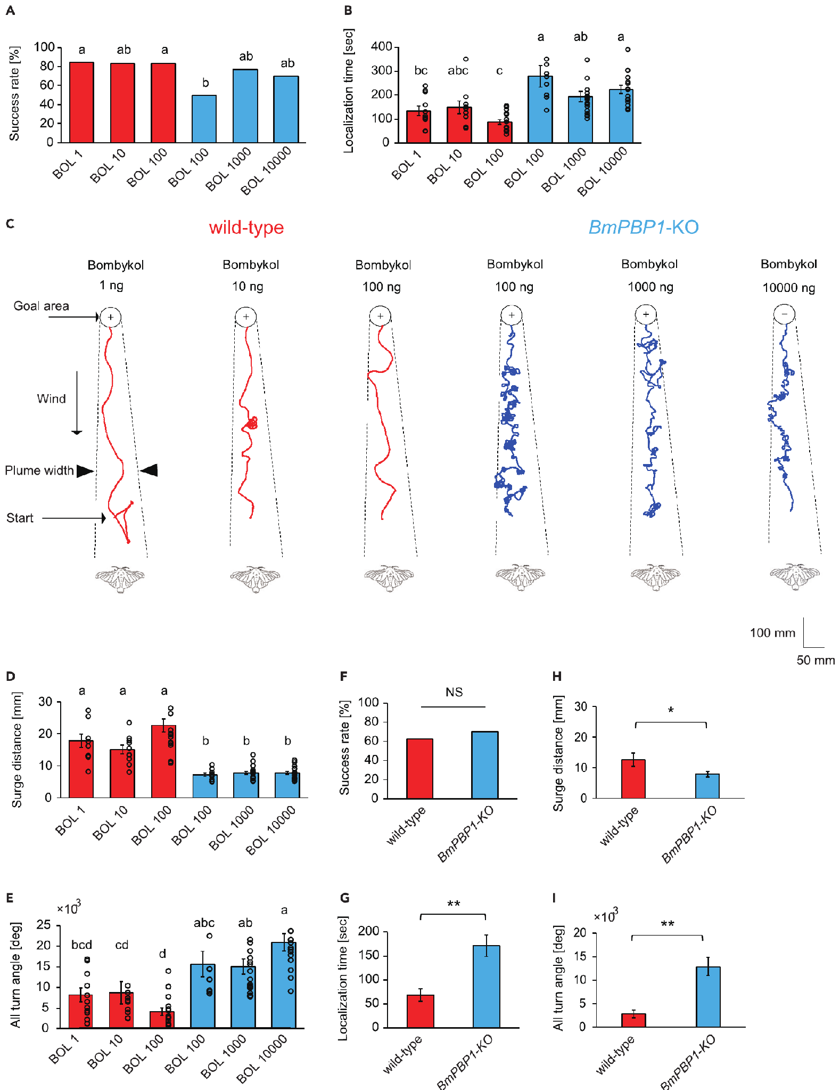
Binding-protein loss delays source finding
Shiota and colleagues allowed males to walk freely in a wind tunnel toward pulsed bombykol or real females. Normal moths received 1–100 ng bombykol source loads; knockouts received 100–10,000 ng to compensate for lower sensitivity. Source-finding success and time were measured separately.
Both groups could locate the source, with similar success across the tested treatments. Knockouts took longer, followed shorter forward surges and accumulated more turning. Searching toward real females produced the same qualitative combination of preserved success and reduced efficiency.
The loss of BmPBP1 therefore impairs efficient navigation without abolishing odor-guided searching. Dose comparisons and female-source tests weaken a simple insufficient-dose explanation. The delay therefore reflects poorer resetting of the search at each odor contact.
Shiota et al. (2021), Fig. 5(A–I). Source-finding performance for synthetic pheromone and females.
Shiota et al. (2021)
24
Notes:
• Shiota and colleagues allowed males to walk freely in a wind tunnel toward pulsed bombykol or real females. Normal moths received 1–100 ng bombykol source loads; knockouts received 100–10,000 ng to compensate for lower sensitivity. Source-finding success and time were measured separately.
– Arrival time and success answer different questions. A sensory system can retain the ability to reach a source while losing the timing precision required for rapid progress.
• Both groups could locate the source, with similar success across the tested treatments. Knockouts took longer, followed shorter forward surges and accumulated more turning. Searching toward real females produced the same qualitative combination of preserved success and reduced efficiency.
• The loss of BmPBP1 therefore impairs efficient navigation without abolishing odor-guided searching. Dose comparisons and female-source tests weaken a simple insufficient-dose explanation. The delay therefore reflects poorer resetting of the search at each odor contact.
References:
Shiota Y, Sakurai T, Ando N, Haupt SS, Mitsuno H, Daimon T, Kanzaki R (2021). Pheromone binding protein is involved in temporal olfactory resolution in the silkmoth. iScience 24(11):103334. https://doi.org/10.1016/j.isci.2021.103334
Figure: Shiota et al. (2021), Fig. 5(A–I). Source-finding performance for synthetic pheromone and females.
Figure source: https://doi.org/10.1016/j.isci.2021.103334

Slide 33
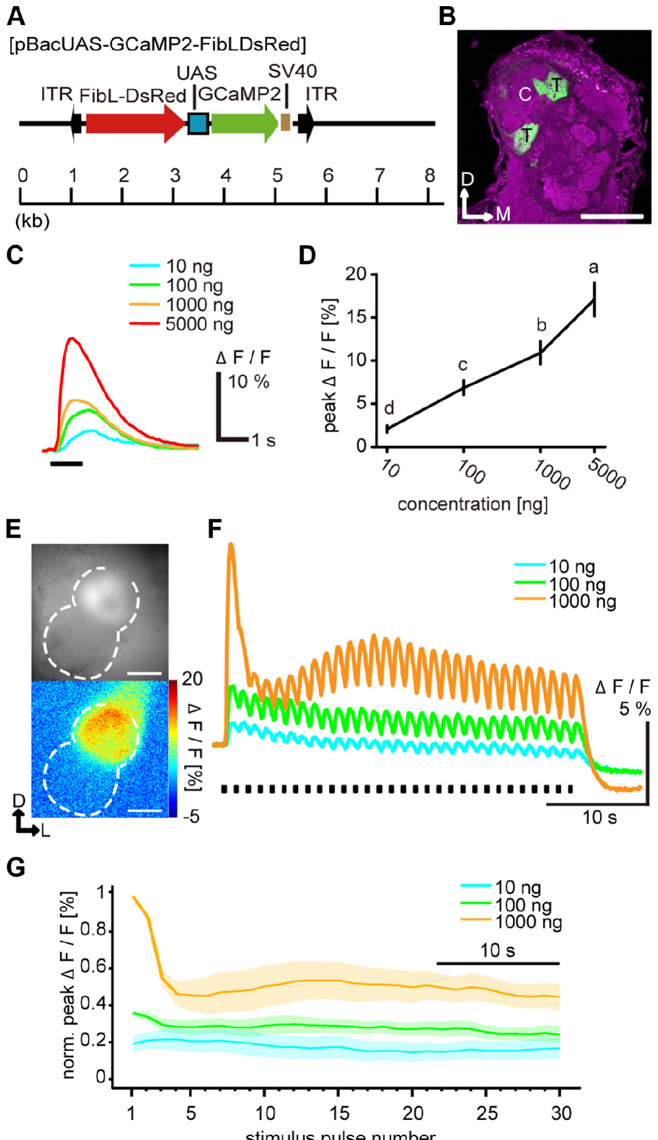
A dedicated glomerulus relays bombykol input
The antennal lobe is the first central olfactory processing region. Bombykol-sensitive ORNs terminate in its toroid, where projection neurons, or PNs, carry processed information toward higher brain regions. Local interneurons connect within the antennal lobe and influence its input–output transformation.
Fujiwara and colleagues expressed GCaMP, a calcium-sensitive fluorescent protein, selectively in BmOR1 neurons. Their axon terminals were localized to the toroid. Calcium signals increased with bombykol source load and remained concentration dependent during repeated 200-ms pulses delivered every 1.2 s.
Sensory-terminal signals thus retained dose dependence even when downstream PN firing became less dose dependent after repeated stimulation. The comparison locates an additional transformation within the central pathway. GCaMP fluorescence in the toroid reports calcium in sensory terminals, so it measures the input that the projection neurons receive.
Fujiwara et al. (2014), Fig. 4(A–G). Sensory-terminal anatomy and concentration-dependent calcium responses.
Fujiwara et al. (2014)
25
Notes:
• The antennal lobe is the first central olfactory processing region. Bombykol-sensitive ORNs terminate in its toroid, where projection neurons, or PNs, carry processed information toward higher brain regions. Local interneurons connect within the antennal lobe and influence its input–output transformation.
– A neuropil is a region rich in neuronal processes and synapses. Anatomical labeling establishes where the sensory terminals lie; the calcium assay measures changing activity in those terminals.
• Fujiwara and colleagues expressed GCaMP, a calcium-sensitive fluorescent protein, selectively in BmOR1 neurons. Their axon terminals were localized to the toroid. Calcium signals increased with bombykol source load and remained concentration dependent during repeated 200-ms pulses delivered every 1.2 s.
• Sensory-terminal signals thus retained dose dependence even when downstream PN firing became less dose dependent after repeated stimulation. The comparison locates an additional transformation within the central pathway. GCaMP fluorescence in the toroid reports calcium in sensory terminals, so it measures the input that the projection neurons receive.
References:
Fujiwara T, Kazawa T, Sakurai T, Fukushima R, Uchino K, Yamagata T, Namiki S, Haupt SS, Kanzaki R (2014). Odorant Concentration Differentiator for Intermittent Olfactory Signals. The Journal of Neuroscience 34(50):16581-16593. https://doi.org/10.1523/jneurosci.2319-14.2014
Figure: Fujiwara et al. (2014), Fig. 4(A–G). Sensory-terminal anatomy and concentration-dependent calcium responses.
Figure source: https://doi.org/10.1523/jneurosci.2319-14.2014

Slide 34
GCaMP reports neural activity as fluorescence
GCaMP is a calcium-sensitive fluorescent protein. Calcium enters active neuronal terminals, and the protein becomes brighter when it binds calcium, so fluorescence provides an indirect measure of activity in the labeled cells.
Fujiwara and colleagues expressed GCaMP selectively in BmOR1 neurons, and the labeled axon terminals were localized to the toroid. Calcium signals increased with bombykol source load and remained concentration dependent during repeated 200-ms pulses delivered every 1.2 s.
Sensory-terminal signals thus retained dose dependence even when downstream projection neuron firing became less dose dependent after repeated stimulation. The comparison locates an additional transformation within the central pathway, between the sensory terminals and the projection neurons. Fluorescence therefore reports the input side of the circuit.
Fujiwara et al. (2014), Fig. 4(A–G). Sensory-terminal anatomy and concentration-dependent calcium responses.
Fujiwara et al. (2014)
25a
Notes:
• A fluorescent protein can report activity in a defined set of neurons.
• Definition.
– GCaMP is a calcium-sensitive fluorescent protein.
– It brightens when it binds calcium.
• Why calcium.
– Calcium enters active neuronal terminals.
– Fluorescence is therefore an indirect measure of activity.
• Targeting.
– GCaMP was expressed selectively in BmOR1 neurons.
– The labeled terminals were localized to the toroid.
• Stimulus.
– Bombykol pulses lasted 200 milliseconds.
– They were delivered every 1.2 seconds.
• Result.
– Calcium signals increased with bombykol source load.
– They stayed concentration dependent during repeated pulses.
• Comparison.
– Projection neuron firing became less dose dependent after repeated stimulation.
– An additional transformation occurs within the central pathway.
• Why the toroid.
– Bombykol-sensitive ORNs terminate in the toroid.
– Projection neurons carry processed information toward higher brain regions.
• Local interneurons.
– Local interneurons connect within the antennal lobe.
– They influence its input and output transformation.
• Result.
– Sensory-terminal calcium kept dose dependence while projection neuron firing lost it.
• Terms.
– Projection neurons are abbreviated PNs.
References:
Fujiwara T, Kazawa T, Sakurai T, Fukushima R, Uchino K, Yamagata T, Namiki S, Haupt SS, Kanzaki R (2014). Odorant Concentration Differentiator for Intermittent Olfactory Signals. The Journal of Neuroscience 34(50):16581-16593. https://doi.org/10.1523/jneurosci.2319-14.2014

Slide 35
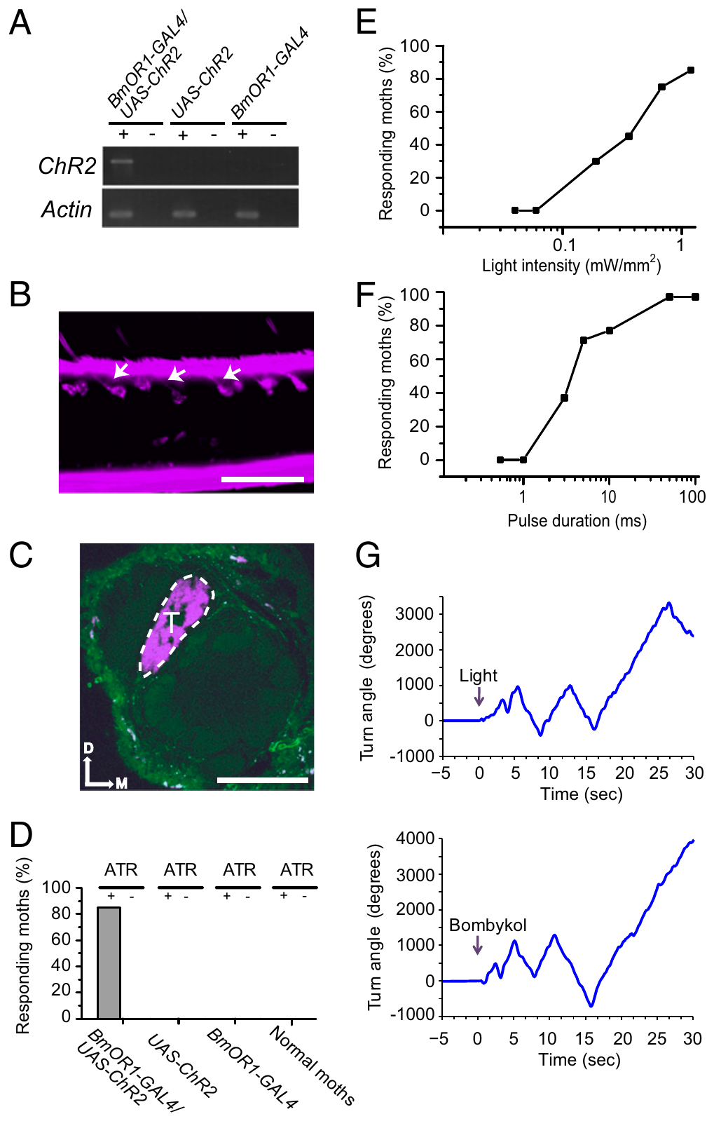
Optogenetics controls sensory input timing
Optogenetics uses a light-sensitive protein to control selected cells. Tabuchi and colleagues expressed channelrhodopsin-2, or ChR2, in Bombyx bombykol-sensitive ORNs. ChR2 is a light-gated membrane channel; this intervention bypassed odor delivery while retaining the existing pheromone pathway.
Blue-light stimulation evoked sensory spikes and pheromone-like wing flapping and zigzag turns. Controls lacking one genetic component, antennae or the required retinal cofactor did not respond in the same way. Light wavelength controls further separated ChR2 activation from a general behavioral effect of illumination.
The preparation gives millisecond control over afferent timing, allowing central integration to be tested without uncertain plume transit or binding kinetics. Selective stimulation of an identified input channel allows the timing of afferent activity to be set directly while the existing pheromone pathway stays in place.
Tabuchi et al. (2013), Fig. 1(A–H). Selective receptor-neuron activation and resulting behavior.
Tabuchi et al. (2013)
26
Notes:
• Optogenetics uses a light-sensitive protein to control selected cells. Tabuchi and colleagues expressed channelrhodopsin-2, or ChR2, in Bombyx bombykol-sensitive ORNs. ChR2 is a light-gated membrane channel; this intervention bypassed odor delivery while retaining the existing pheromone pathway.
– An afferent signal travels from a sensory organ toward a central processing region. The fluorescently marked axons still entered the toroid, connecting the manipulated input to its known central target.
• Blue-light stimulation evoked sensory spikes and pheromone-like wing flapping and zigzag turns. Controls lacking one genetic component, antennae or the required retinal cofactor did not respond in the same way. Light wavelength controls further separated ChR2 activation from a general behavioral effect of illumination.
• The preparation gives millisecond control over afferent timing, allowing central integration to be tested without uncertain plume transit or binding kinetics. Selective stimulation of an identified input channel allows the timing of afferent activity to be set directly while the existing pheromone pathway stays in place.
References:
Tabuchi M, Sakurai T, Mitsuno H, Namiki S, Minegishi R, Shiotsuki T, Uchino K, Sezutsu H, Tamura T, Haupt SS, Nakatani K, Kanzaki R (2013). Pheromone responsiveness threshold depends on temporal integration by antennal lobe projection neurons. Proceedings of the National Academy of Sciences 110(38):15455-15460. https://doi.org/10.1073/pnas.1313707110
Figure: Tabuchi et al. (2013), Fig. 1(A–H). Selective receptor-neuron activation and resulting behavior.
Figure source: https://doi.org/10.1073/pnas.1313707110

Slide 36
Afferent input is the signal sent to the brain
Afferent neurons carry signals from a sensory organ toward the central nervous system. In the silkmoth, the afferents of the pheromone system are the bombykol-sensitive olfactory receptor neurons, whose axons project to the toroid.
Tabuchi and colleagues expressed channelrhodopsin-2 in these neurons, so blue light activated the afferent input and bypassed odor delivery. Light evoked sensory spikes, wing flapping and zigzag turns. Controls lacking one genetic component, antennae or the retinal cofactor did not respond in the same way.
Setting afferent timing with light gives millisecond control, so central integration can be tested without uncertain plume transit or binding kinetics. The existing pheromone pathway remains in place, which means that any behavior arises from the identified input channel.
Tabuchi et al. (2013), Fig. 1(A–H). Selective receptor-neuron activation and resulting behavior.
Tabuchi et al. (2013)
26a
Notes:
• Light replaces odor as the source of afferent activity.
• Definition.
– Afferent neurons carry signals from a sensory organ toward the central nervous system.
• Silkmoth afferents.
– Bombykol-sensitive olfactory receptor neurons are the afferents of this pheromone system.
– Their axons project to the toroid.
• Manipulation.
– Channelrhodopsin-2 was expressed in these neurons.
– Blue light activated them and bypassed odor delivery.
• Result.
– Light evoked sensory spikes.
– It also evoked wing flapping and zigzag turns.
• Controls.
– Controls lacked one genetic component, the antennae or the retinal cofactor.
– They did not respond in the same way.
• Meaning.
– Millisecond control of afferent timing removes uncertain plume transit and binding kinetics.
• Channelrhodopsin-2.
– ChR2 is a light-gated membrane channel.
– Its activation by blue light depolarizes the neuron it is expressed in.
• Wavelength control.
– Different wavelengths separated activation of the channel from a general effect of illumination.
• Spikes.
– Blue light evoked sensory spikes in the targeted neurons.
– The behavior resembled pheromone-evoked wing flapping and zigzag turns.
• Precision.
– Light pulses of defined duration set the timing of input with millisecond control.
References:
Tabuchi M, Sakurai T, Mitsuno H, Namiki S, Minegishi R, Shiotsuki T, Uchino K, Sezutsu H, Tamura T, Haupt SS, Nakatani K, Kanzaki R (2013). Pheromone responsiveness threshold depends on temporal integration by antennal lobe projection neurons. Proceedings of the National Academy of Sciences 110(38):15455-15460. https://doi.org/10.1073/pnas.1313707110

Slide 37
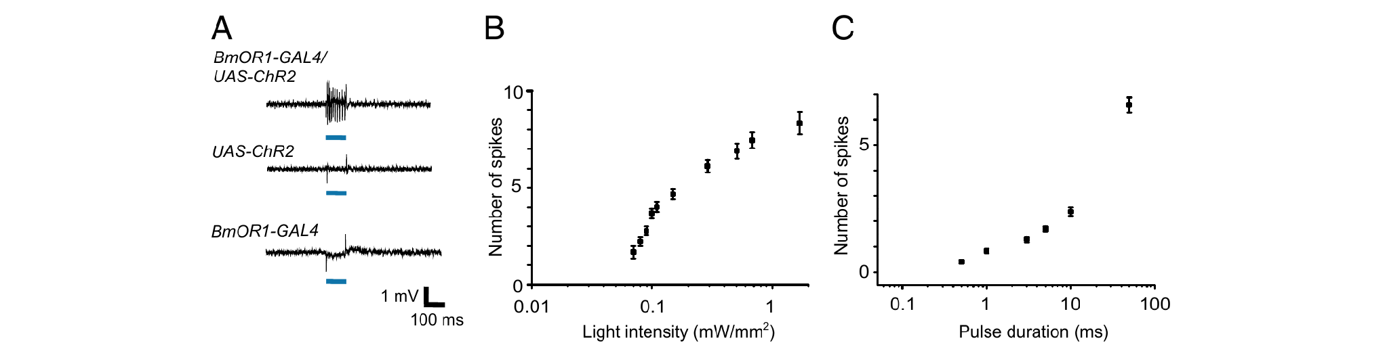
Brief light pulses regulate sensory spike output
Tabuchi and colleagues recorded spikes from pheromone-sensitive sensilla while activating ChR2-expressing neurons. Increasing light intensity or pulse duration increased the sensory response. Bombykol and blue light evoked spikes of the same amplitude from the targeted unit; parental genetic controls lacked the light response.
Paired light pulses could therefore impose a reproducible temporal pattern on the bombykol channel. The authors compared 3-ms pulses, near behavioral threshold, with 10-ms pulses producing strong behavioral responsiveness. These durations define weak and strong input for this optogenetic preparation.
Light intensity and pulse duration set the spike output of the bombykol neuron, defining weak 3-ms and strong 10-ms input. Because the receptor neuron spikes are measured directly, the input to the central circuit is defined by recorded spikes and not only by light duration.
Tabuchi et al. (2013), Fig. 2(A–C). Light pulses control sensory-neuron spike output.
Sakurai et al. (2011), Fig. 1(A–D). Receptor expression and sensory-cell localization in the antenna.
Tabuchi et al. (2013); Sakurai et al. (2011)
27
Notes:
• Tabuchi and colleagues recorded spikes from pheromone-sensitive sensilla while activating ChR2-expressing neurons. Increasing light intensity or pulse duration increased the sensory response. Bombykol and blue light evoked spikes of the same amplitude from the targeted unit; parental genetic controls lacked the light response.
– A short stimulus can initiate multiple spikes. The effective input to the brain is that transmitted activity, rather than the duration of illumination considered in isolation.
• Paired light pulses could therefore impose a reproducible temporal pattern on the bombykol channel. The authors compared 3-ms pulses, near behavioral threshold, with 10-ms pulses producing strong behavioral responsiveness. These durations define weak and strong input for this optogenetic preparation.
• Light intensity and pulse duration set the spike output of the bombykol neuron, defining weak 3-ms and strong 10-ms input. Because the receptor neuron spikes are measured directly, the input to the central circuit is defined by recorded spikes and not only by light duration.
References:
Tabuchi M, Sakurai T, Mitsuno H, Namiki S, Minegishi R, Shiotsuki T, Uchino K, Sezutsu H, Tamura T, Haupt SS, Nakatani K, Kanzaki R (2013). Pheromone responsiveness threshold depends on temporal integration by antennal lobe projection neurons. Proceedings of the National Academy of Sciences 110(38):15455-15460. https://doi.org/10.1073/pnas.1313707110
Sakurai T, Mitsuno H, Haupt SS, Uchino K, Yokohari F, Nishioka T, Kobayashi I, Sezutsu H, Tamura T, Kanzaki R (2011). A Single Sex Pheromone Receptor Determines Chemical Response Specificity of Sexual Behavior in the Silkmoth Bombyx mori. PLoS Genetics 7(6):e1002115. https://doi.org/10.1371/journal.pgen.1002115
Figure: Tabuchi et al. (2013), Fig. 2(A–C). Light pulses control sensory-neuron spike output.
Figure source: https://doi.org/10.1073/pnas.1313707110
Figure: Sakurai et al. (2011), Fig. 1(A–D). Receptor expression and sensory-cell localization in the antenna.
Figure source: https://doi.org/10.1371/journal.pgen.1002115

Slide 38
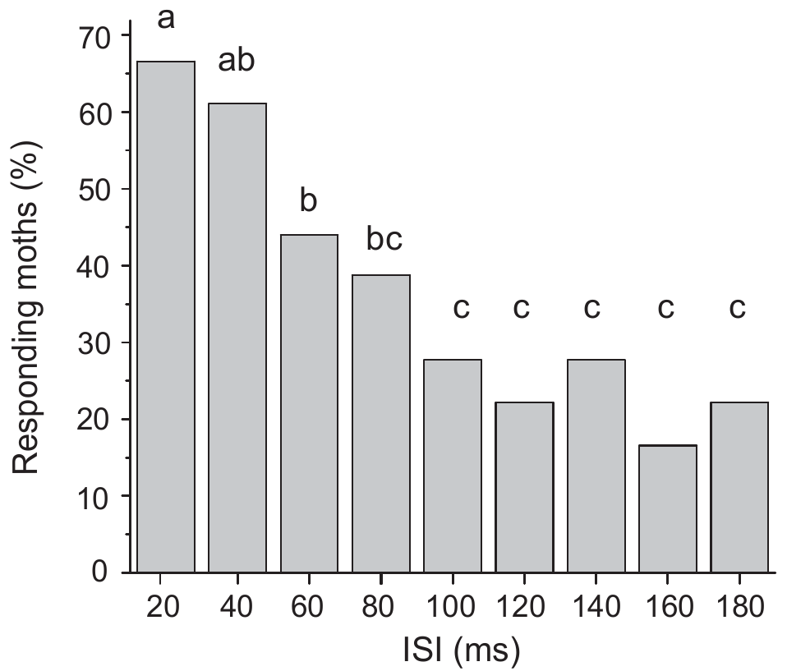
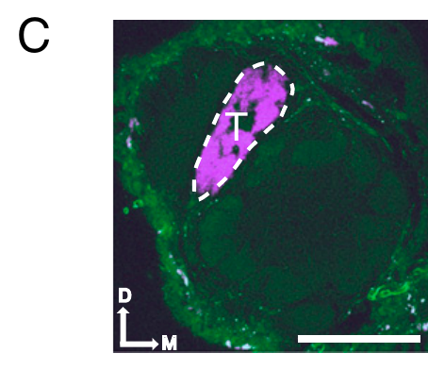
Short intervals enhance behavioral responsiveness
Tabuchi and colleagues delivered two 3-ms light pulses to the bombykol sensory channel while varying the interstimulus interval, the time separating the pulses. Each pulse alone supplied weak input. The experiment tested whether closely spaced inputs could combine to cross the behavioral response threshold.
At intervals of 100–180 ms, only about 17–28% of males responded. When the interval was below 80 ms, responsiveness increased more than twofold. The response depended on timing even though the number and duration of presented pulses remained controlled.
Temporal integration is the combination of inputs arriving over a limited period. Two weak pulses spaced below 80 ms combine to cross the behavioral threshold, which defines an integration window of tens of milliseconds.
Tabuchi et al. (2013), Fig. 1(C). Bombykol sensory axons terminate in the toroid.
Tabuchi et al. (2013), Fig. 3(single panel). Short interstimulus intervals enhance behavioral responsiveness.
Tabuchi et al. (2013)
28
Notes:
• Tabuchi and colleagues delivered two 3-ms light pulses to the bombykol sensory channel while varying the interstimulus interval, the time separating the pulses. Each pulse alone supplied weak input. The experiment tested whether closely spaced inputs could combine to cross the behavioral response threshold.
– A behavioral threshold is a boundary for expression of the scored response, not a claim that subthreshold stimulation is undetected by every neuron in the pathway.
• At intervals of 100–180 ms, only about 17–28% of males responded. When the interval was below 80 ms, responsiveness increased more than twofold. The response depended on timing even though the number and duration of presented pulses remained controlled.
• Temporal integration is the combination of inputs arriving over a limited period. Two weak pulses spaced below 80 ms combine to cross the behavioral threshold, which defines an integration window of tens of milliseconds.
References:
Tabuchi M, Sakurai T, Mitsuno H, Namiki S, Minegishi R, Shiotsuki T, Uchino K, Sezutsu H, Tamura T, Haupt SS, Nakatani K, Kanzaki R (2013). Pheromone responsiveness threshold depends on temporal integration by antennal lobe projection neurons. Proceedings of the National Academy of Sciences 110(38):15455-15460. https://doi.org/10.1073/pnas.1313707110
Figure: Tabuchi et al. (2013), Fig. 3(single panel). Short interstimulus intervals enhance behavioral responsiveness.
Figure source: https://doi.org/10.1073/pnas.1313707110
Figure: Tabuchi et al. (2013), Fig. 1(C). Bombykol sensory axons terminate in the toroid.
Figure source: https://doi.org/10.1073/pnas.1313707110

Slide 39
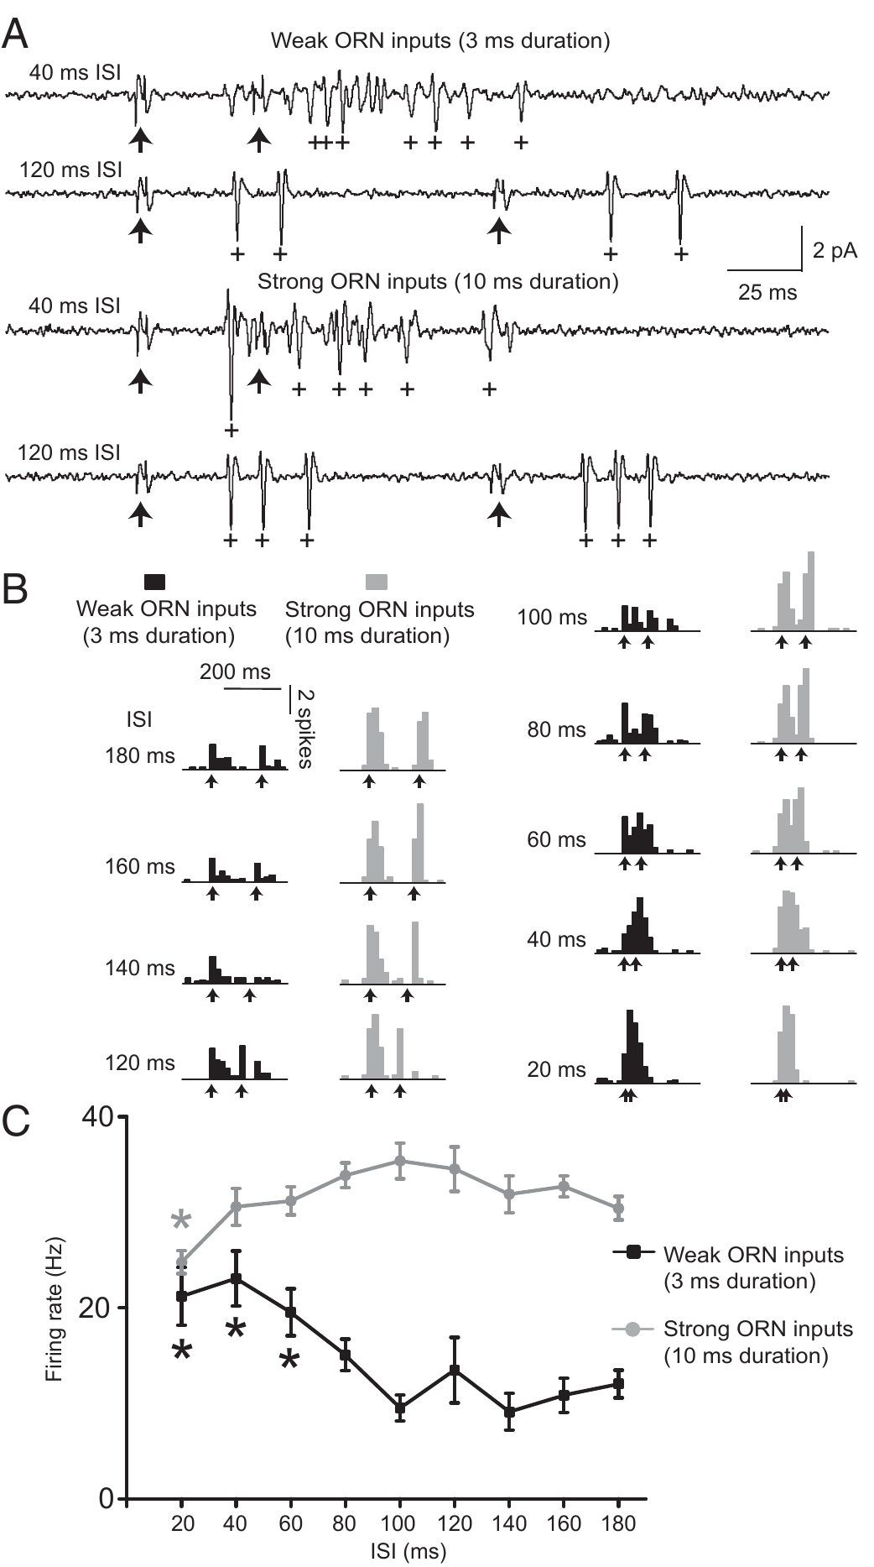
Weak input is amplified in projection neurons
Tabuchi and colleagues recorded toroid projection neurons while presenting paired optogenetic inputs. At long intervals, the two responses remained temporally separated. With weak 3-ms pulses separated by 20–60 ms, the combined PN spike output exceeded the response obtained with widely separated pulses.
The integration window matched the interval range that enhanced behavior. Peripheral ORNs did not exhibit the same supralinear enhancement, and variation in conduction through the antennal nerve was negligible. These controls place the amplification after the recorded sensory input rather than in odor delivery.
Supralinear integration means output exceeds simple addition of the separate responses. Enhancement appears in projection neurons and is absent from the ORNs, so the supralinear step occurs after the sensory input, and its interval range matches the behavioral window.
Tabuchi et al. (2013), Fig. 1(C). Bombykol sensory axons terminate in the toroid.
Tabuchi et al. (2013), Fig. 4(A–C). Weak and strong paired sensory inputs evoke different projection-neuron integration.
Tabuchi et al. (2013)
29
Notes:
• Tabuchi and colleagues recorded toroid projection neurons while presenting paired optogenetic inputs. At long intervals, the two responses remained temporally separated. With weak 3-ms pulses separated by 20–60 ms, the combined PN spike output exceeded the response obtained with widely separated pulses.
– Closely timed weak inputs can become effective together even if either is insufficient by itself. This temporal dependence increases sensitivity to brief clustered encounters.
• The integration window matched the interval range that enhanced behavior. Peripheral ORNs did not exhibit the same supralinear enhancement, and variation in conduction through the antennal nerve was negligible. These controls place the amplification after the recorded sensory input rather than in odor delivery.
• Supralinear integration means output exceeds simple addition of the separate responses. Enhancement appears in projection neurons and is absent from the ORNs, so the supralinear step occurs after the sensory input, and its interval range matches the behavioral window.
References:
Tabuchi M, Sakurai T, Mitsuno H, Namiki S, Minegishi R, Shiotsuki T, Uchino K, Sezutsu H, Tamura T, Haupt SS, Nakatani K, Kanzaki R (2013). Pheromone responsiveness threshold depends on temporal integration by antennal lobe projection neurons. Proceedings of the National Academy of Sciences 110(38):15455-15460. https://doi.org/10.1073/pnas.1313707110
Figure: Tabuchi et al. (2013), Fig. 4(A–C). Weak and strong paired sensory inputs evoke different projection-neuron integration.
Figure source: https://doi.org/10.1073/pnas.1313707110
Figure: Tabuchi et al. (2013), Fig. 1(C). Bombykol sensory axons terminate in the toroid.
Figure source: https://doi.org/10.1073/pnas.1313707110

Slide 40
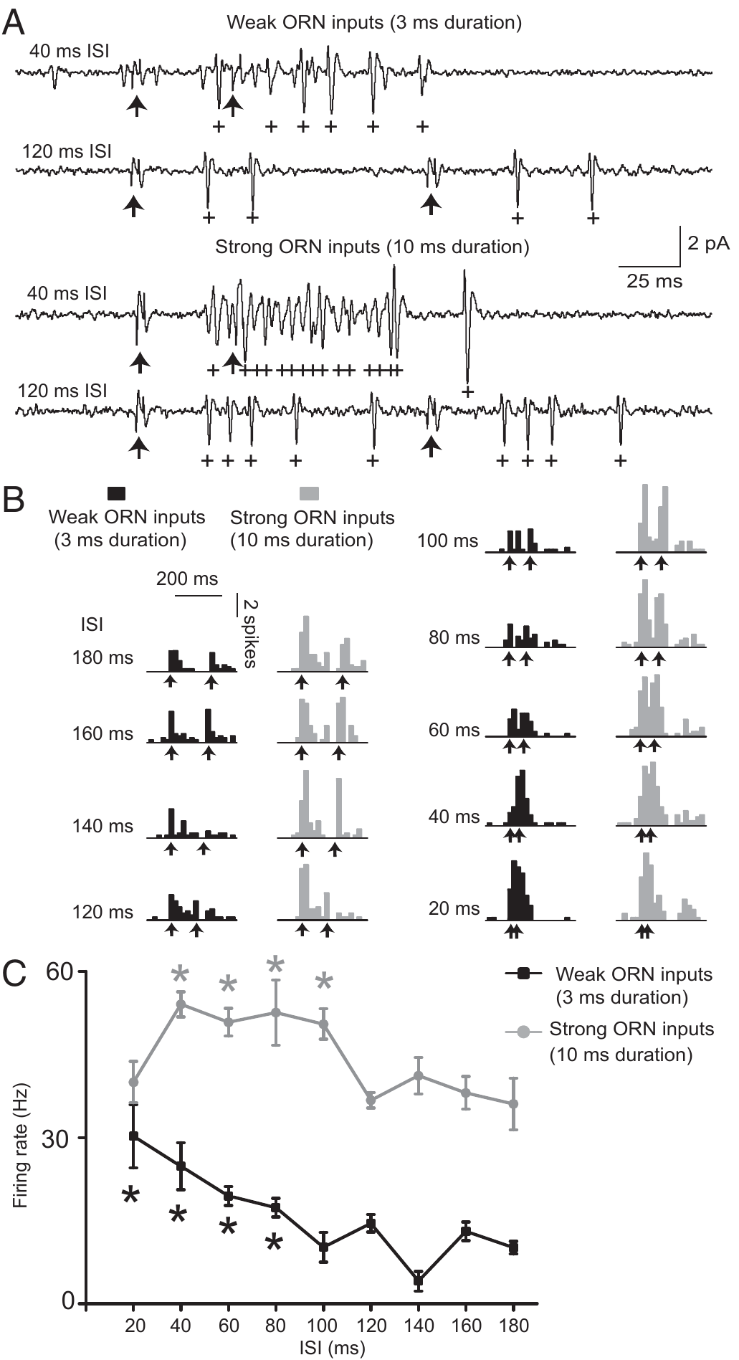
GABA limits integration of strong sensory input
GABA, gamma-aminobutyric acid, is an inhibitory neurotransmitter used by many antennal-lobe local interneurons. Tabuchi and colleagues tested its contribution by combining blockers of GABA-A and GABA-B receptors during PN recordings. These receptor classes differ in their cellular signaling mechanisms.
Normal PNs integrated weak inputs but did not exhibit the same supralinear response to strong 10-ms pulses. After receptor blockade, strong inputs separated by about 40–100 ms could produce supralinear integration. Spontaneous and light-evoked firing also increased, consistent with removal of inhibition.
GABA-dependent inhibition therefore constrains integration when sensory input is strong, favoring temporal separation. Weak-input integration persisted during blockade, so inhibition regulates an integration capacity rather than creating it.
Tabuchi et al. (2013), Fig. 1(C). Bombykol sensory axons terminate in the toroid.
Tabuchi et al. (2013), Fig. 5(A–C). GABA-receptor blockade exposes integration of strong inputs.
Tabuchi et al. (2013)
30
Notes:
• GABA, gamma-aminobutyric acid, is an inhibitory neurotransmitter used by many antennal-lobe local interneurons. Tabuchi and colleagues tested its contribution by combining blockers of GABA-A and GABA-B receptors during PN recordings. These receptor classes differ in their cellular signaling mechanisms.
– GABA-A receptors are associated with ion-channel inhibition, whereas GABA-B receptors signal through G proteins. The study establishes pharmacological involvement without resolving the exact synaptic implementation.
• Normal PNs integrated weak inputs but did not exhibit the same supralinear response to strong 10-ms pulses. After receptor blockade, strong inputs separated by about 40–100 ms could produce supralinear integration. Spontaneous and light-evoked firing also increased, consistent with removal of inhibition.
• GABA-dependent inhibition therefore constrains integration when sensory input is strong, favoring temporal separation. Weak-input integration persisted during blockade, so inhibition regulates an integration capacity rather than creating it.
References:
Tabuchi M, Sakurai T, Mitsuno H, Namiki S, Minegishi R, Shiotsuki T, Uchino K, Sezutsu H, Tamura T, Haupt SS, Nakatani K, Kanzaki R (2013). Pheromone responsiveness threshold depends on temporal integration by antennal lobe projection neurons. Proceedings of the National Academy of Sciences 110(38):15455-15460. https://doi.org/10.1073/pnas.1313707110
Figure: Tabuchi et al. (2013), Fig. 5(A–C). GABA-receptor blockade exposes integration of strong inputs.
Figure source: https://doi.org/10.1073/pnas.1313707110
Figure: Tabuchi et al. (2013), Fig. 1(C). Bombykol sensory axons terminate in the toroid.
Figure source: https://doi.org/10.1073/pnas.1313707110

Slide 41
Receptor blockers reveal the role of inhibition
A receptor antagonist is a drug that occupies a receptor and prevents its normal transmitter from acting. Applying an antagonist removes signaling through that receptor, so the change in the recorded cells shows what the transmitter normally does.
Tabuchi and colleagues combined blockers of GABA-A and GABA-B receptors during projection neuron recordings. After blockade, strong inputs separated by about 40–100 ms could produce supralinear integration. Spontaneous and light-evoked firing also increased.
Normal projection neurons integrated weak inputs in the paired-pulse recordings but lacked the supralinear response to strong 10-ms pulses. The increase in firing after blockade is consistent with removal of inhibition, which indicates that GABA normally limits integration of strong input.
Tabuchi et al. (2013), Fig. 1(C). Bombykol sensory axons terminate in the toroid.
Tabuchi et al. (2013), Fig. 5(A–C). GABA-receptor blockade exposes integration of strong inputs.
Tabuchi et al. (2013)
30a
Notes:
• Blocking a receptor reveals the job of its transmitter.
• Definition.
– An antagonist occupies a receptor and prevents the normal transmitter from acting.
• Logic.
– Removing signaling through a receptor changes the recorded cells.
– The change shows what the transmitter normally does.
• Experiment.
– Blockers of GABA-A and GABA-B receptors were combined.
– Projection neurons were recorded.
• Normal neurons.
– They integrated weak inputs.
– They lacked supralinear integration of strong 10-millisecond pulses.
• After blockade.
– Strong inputs separated by about 40 to 100 milliseconds produced supralinear integration.
– Spontaneous and light-evoked firing also increased.
• Meaning.
– GABA normally limits integration of strong input.
• Receptor classes.
– GABA-A and GABA-B receptors differ in their cellular signaling mechanisms.
– Blocking both removes both forms of GABA signaling.
• Weak input.
– Integration of weak inputs persisted during blockade.
• Inhibitory transmitter.
– GABA is gamma-aminobutyric acid.
– Many antennal-lobe local interneurons use it.
• Result summary.
– Weak inputs integrate with or without GABA signaling.
– Strong inputs integrate only after GABA receptors are blocked.
References:
Tabuchi M, Sakurai T, Mitsuno H, Namiki S, Minegishi R, Shiotsuki T, Uchino K, Sezutsu H, Tamura T, Haupt SS, Nakatani K, Kanzaki R (2013). Pheromone responsiveness threshold depends on temporal integration by antennal lobe projection neurons. Proceedings of the National Academy of Sciences 110(38):15455-15460. https://doi.org/10.1073/pnas.1313707110

Slide 42
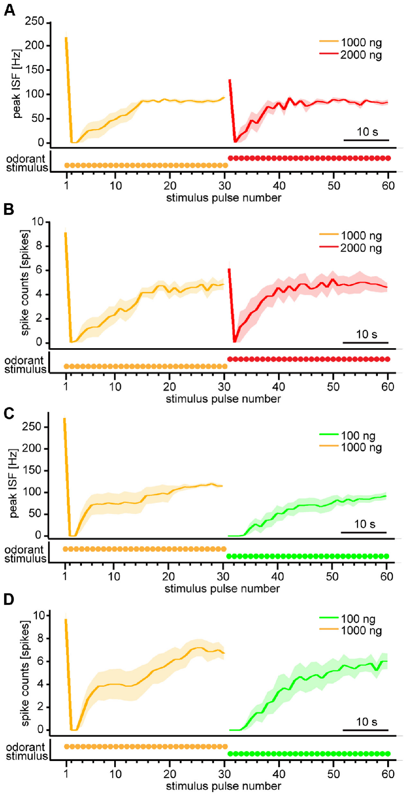
Projection neurons emphasize changes in odor dose
Fujiwara and colleagues presented repeated 200-ms bombykol pulses every 1.2 s and recorded PN spike responses. After the response settled, they increased the source load from 1,000 to 2,000 ng or decreased it from 1,000 to 100 ng while maintaining pulse timing.
A concentration increase briefly enhanced firing before responses returned toward their previous settled level. A decrease initially suppressed responses, followed by recovery. Thus, transient output distinguished the direction of a change even when settled spike output was relatively insensitive to the absolute dose.
An odorant concentration differentiator is the authors’ functional description of this change-sensitive transformation. Transient firing marks the direction of a change in source load, so the pathway reports change in dose more than its absolute level.
Tabuchi et al. (2013), Fig. 1(C). Bombykol sensory axons terminate in the toroid.
Fujiwara et al. (2014), Fig. 3(A–D). Projection-neuron responses to increases and decreases in odor dose.
Fujiwara et al. (2014); Tabuchi et al. (2013)
31
Notes:
• Fujiwara and colleagues presented repeated 200-ms bombykol pulses every 1.2 s and recorded PN spike responses. After the response settled, they increased the source load from 1,000 to 2,000 ng or decreased it from 1,000 to 100 ng while maintaining pulse timing.
– The same increase can evoke a transient response after adaptation without permanently increasing the settled rate. That difference separates change sensitivity from a simple static dose-response relationship.
• A concentration increase briefly enhanced firing before responses returned toward their previous settled level. A decrease initially suppressed responses, followed by recovery. Thus, transient output distinguished the direction of a change even when settled spike output was relatively insensitive to the absolute dose.
• An odorant concentration differentiator is the authors’ functional description of this change-sensitive transformation. Transient firing marks the direction of a change in source load, so the pathway reports change in dose more than its absolute level.
References:
Fujiwara T, Kazawa T, Sakurai T, Fukushima R, Uchino K, Yamagata T, Namiki S, Haupt SS, Kanzaki R (2014). Odorant Concentration Differentiator for Intermittent Olfactory Signals. The Journal of Neuroscience 34(50):16581-16593. https://doi.org/10.1523/jneurosci.2319-14.2014
Tabuchi M, Sakurai T, Mitsuno H, Namiki S, Minegishi R, Shiotsuki T, Uchino K, Sezutsu H, Tamura T, Haupt SS, Nakatani K, Kanzaki R (2013). Pheromone responsiveness threshold depends on temporal integration by antennal lobe projection neurons. Proceedings of the National Academy of Sciences 110(38):15455-15460. https://doi.org/10.1073/pnas.1313707110
Figure: Fujiwara et al. (2014), Fig. 3(A–D). Projection-neuron responses to increases and decreases in odor dose.
Figure source: https://doi.org/10.1523/jneurosci.2319-14.2014
Figure: Tabuchi et al. (2013), Fig. 1(C). Bombykol sensory axons terminate in the toroid.
Figure source: https://doi.org/10.1073/pnas.1313707110

Slide 43
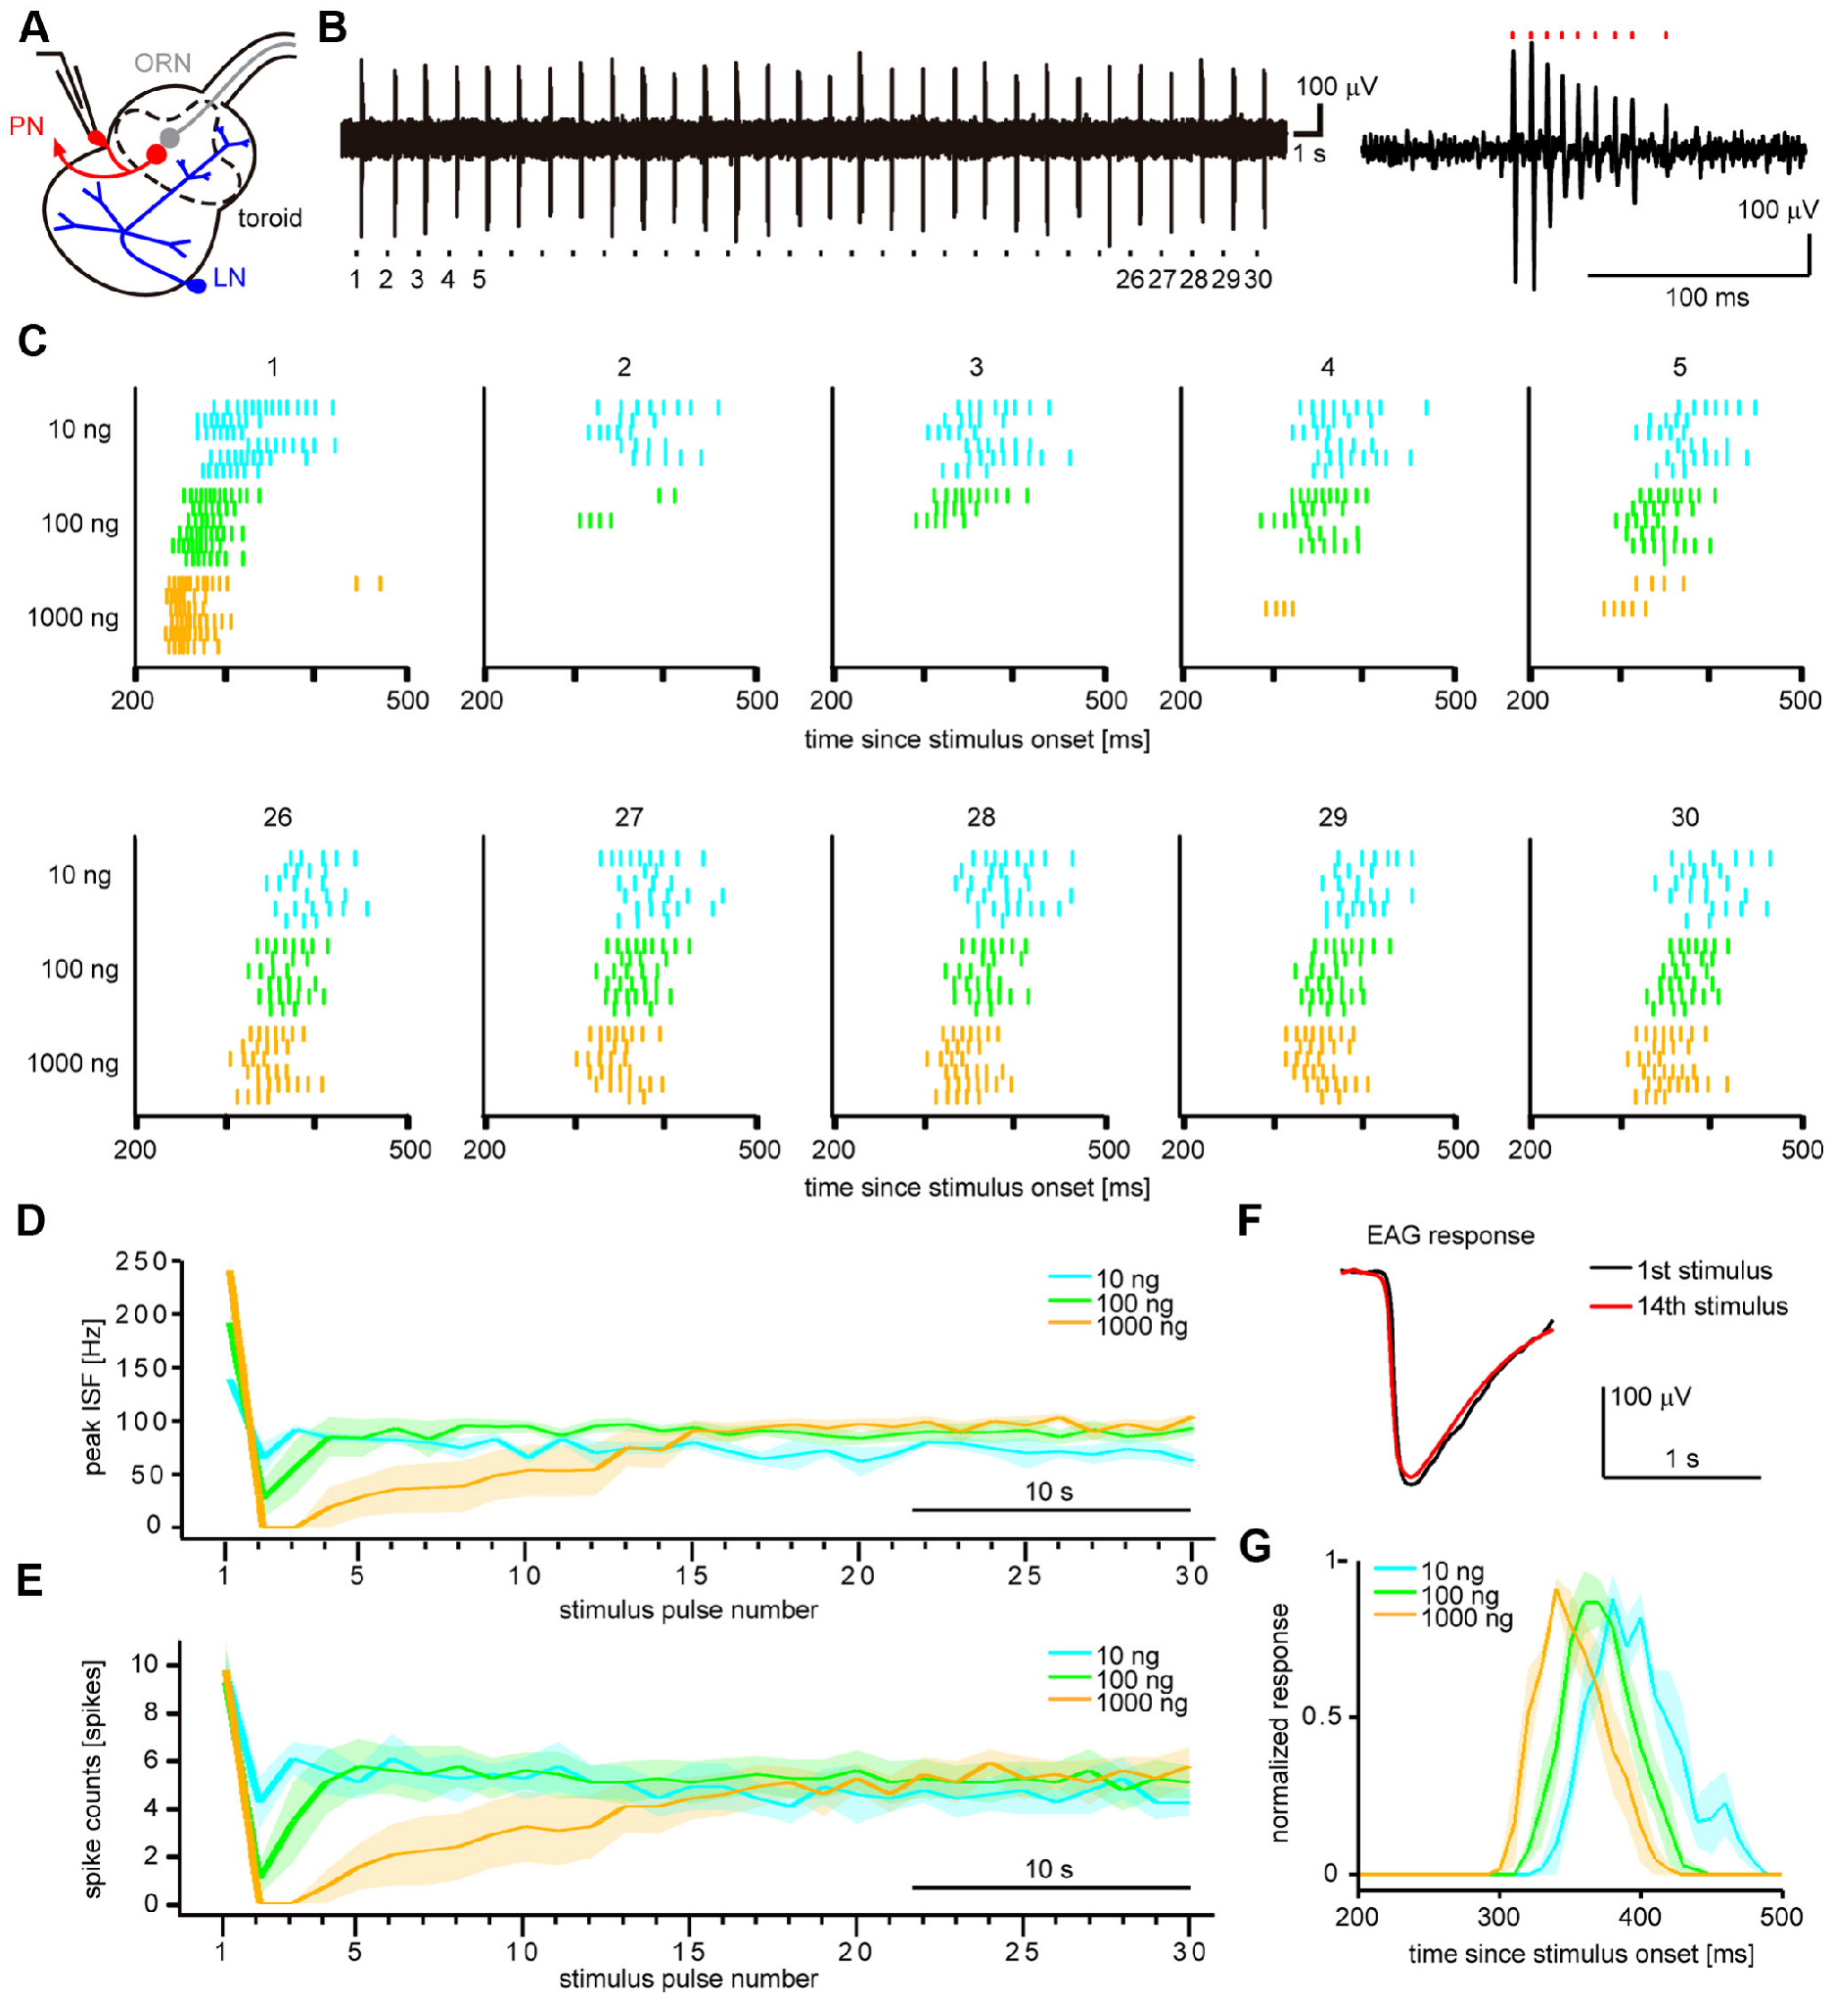
Repeated odor changes the antennal-lobe response
Fujiwara and colleagues recorded toroid PN spikes during repeated bombykol pulses at 0.83 Hz. The first response had a peak firing frequency that increased with source load. Later responses were initially suppressed and then recovered toward a settled output level.
At medium and high source loads, settled spike output became relatively concentration independent. Antennal controls did not show a progressive loss of delivered odor. Some absolute-dose information persisted in timing: reported settled response latencies were about 361, 339 and 322 ms at 10, 100 and 1,000 ng.
Central processing therefore changes which response features carry concentration information. Rate adaptation leaves some absolute-dose information in response timing. Picrotoxin, a GABA-A receptor antagonist, reduced suppression and restored stronger dose dependence, implicating inhibitory processing in the transformation.
Fujiwara et al. (2014), Fig. 2(A–G). Antennal-lobe anatomy and responses to repeated odor pulses.
Fujiwara et al. (2014)
32
Notes:
• Fujiwara and colleagues recorded toroid PN spikes during repeated bombykol pulses at 0.83 Hz. The first response had a peak firing frequency that increased with source load. Later responses were initially suppressed and then recovered toward a settled output level.
– An antagonist reduces receptor-mediated effects. Blocking inhibition changes output, but it cannot by itself identify the exact inhibitory neuron or distinguish every presynaptic and postsynaptic contribution.
• At medium and high source loads, settled spike output became relatively concentration independent. Antennal controls did not show a progressive loss of delivered odor. Some absolute-dose information persisted in timing: reported settled response latencies were about 361, 339 and 322 ms at 10, 100 and 1,000 ng.
• Central processing therefore changes which response features carry concentration information. Rate adaptation leaves some absolute-dose information in response timing. Picrotoxin, a GABA-A receptor antagonist, reduced suppression and restored stronger dose dependence, implicating inhibitory processing in the transformation.
References:
Fujiwara T, Kazawa T, Sakurai T, Fukushima R, Uchino K, Yamagata T, Namiki S, Haupt SS, Kanzaki R (2014). Odorant Concentration Differentiator for Intermittent Olfactory Signals. The Journal of Neuroscience 34(50):16581-16593. https://doi.org/10.1523/jneurosci.2319-14.2014
Figure: Fujiwara et al. (2014), Fig. 2(A–G). Antennal-lobe anatomy and responses to repeated odor pulses.
Figure source: https://doi.org/10.1523/jneurosci.2319-14.2014

Slide 44
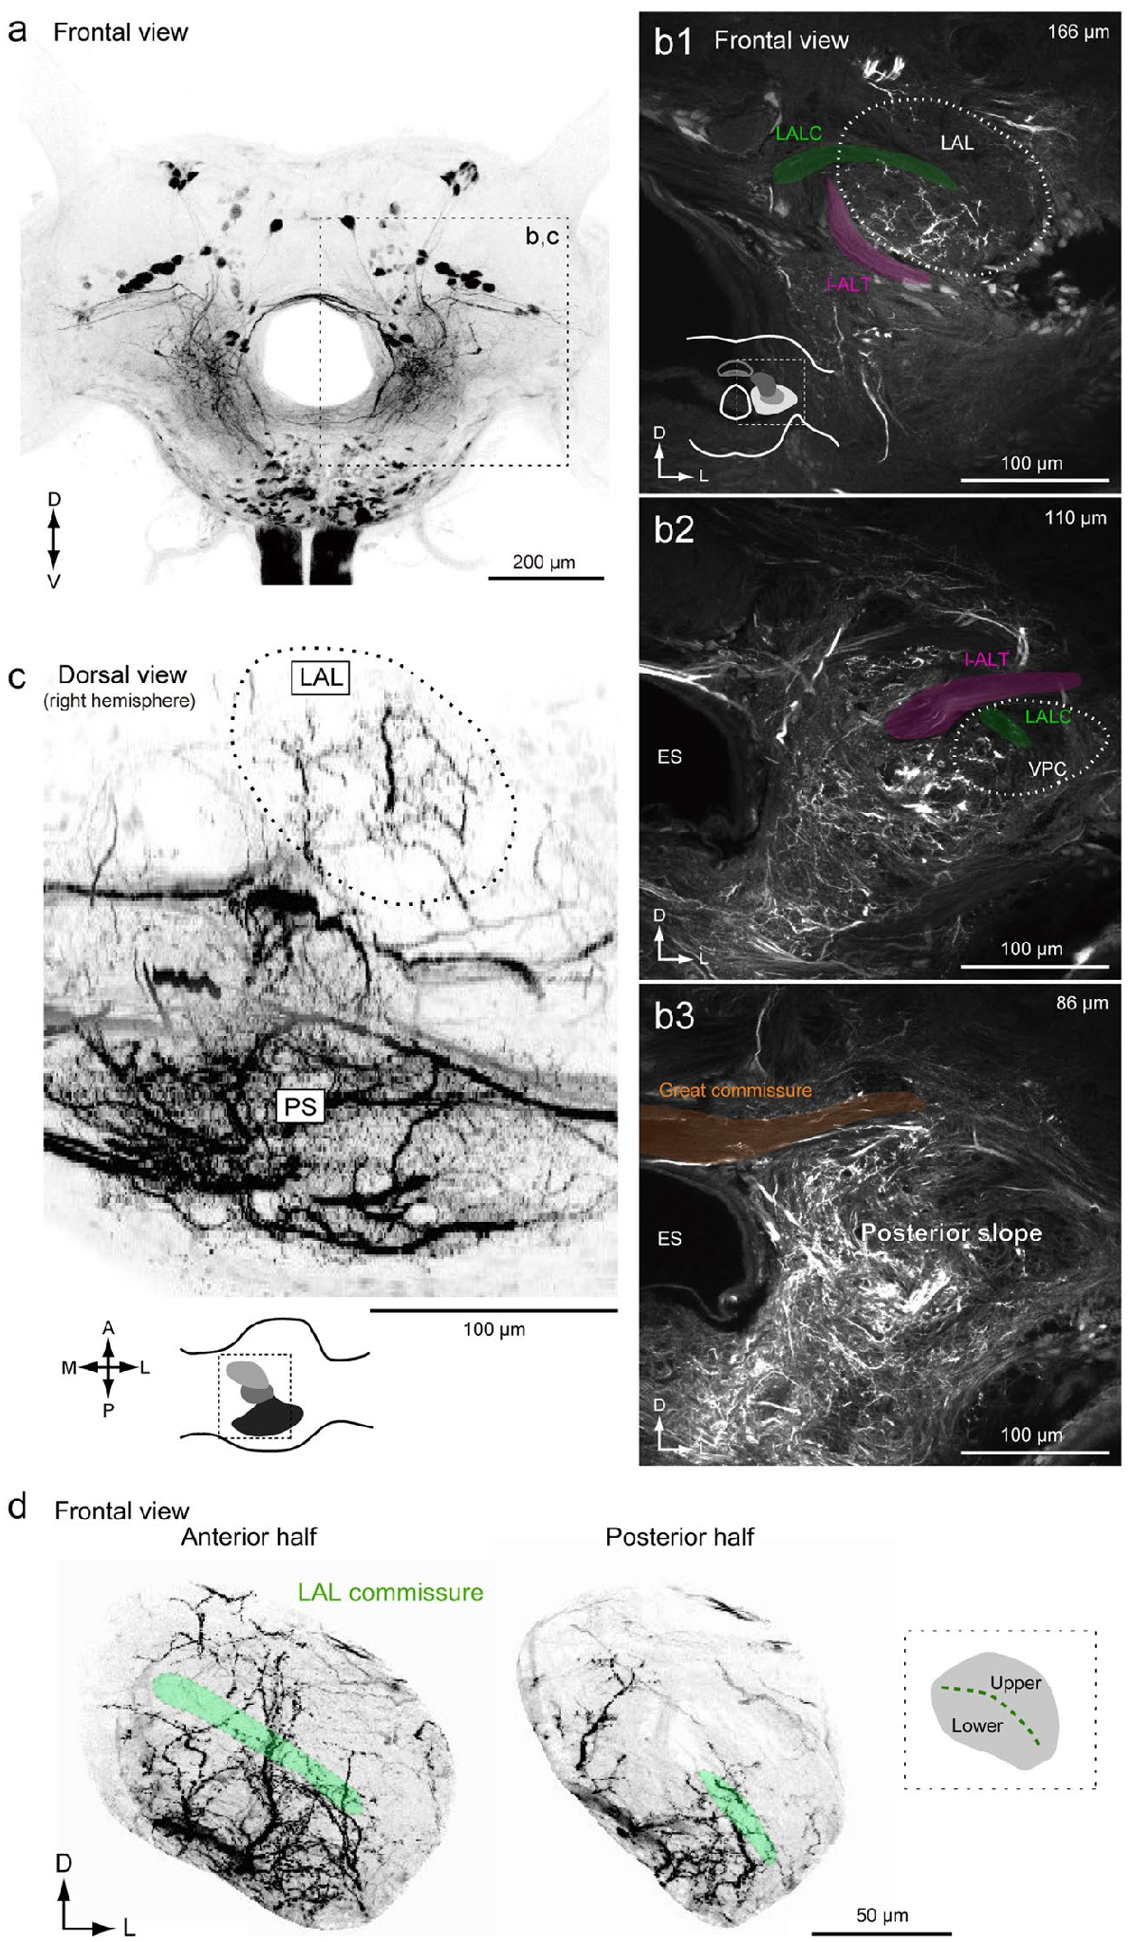
Accessory lobes connect with descending pathways
The lateral accessory lobes, or LALs, are paired higher-order brain regions associated with pheromone-guided motor control. Descending neurons, or DNs, send axons from the brain toward the ventral nervous system and thoracic motor centers. Namiki and colleagues mapped their regional arborizations in Bombyx mori.
Fluorescent dye introduced through the neck connectives labeled descending and ascending fibers. Confocal imaging revealed dense innervation in the posterior slope, a posterior–ventral neuropil. LAL neurons also extended processes into that region, linking two candidate sites of sensorimotor processing.
The anatomy constrains the possible routes by which pheromone information reaches motor pathways. Descending fibers and LAL processes both innervate the posterior slope, so it is a candidate site where pheromone information meets motor pathways.
Namiki et al. (2018), Fig. 2(a–d). Confocal anatomy of lateral accessory lobes and posterior slope.
Namiki et al. (2018)
33
Notes:
• The lateral accessory lobes, or LALs, are paired higher-order brain regions associated with pheromone-guided motor control. Descending neurons, or DNs, send axons from the brain toward the ventral nervous system and thoracic motor centers. Namiki and colleagues mapped their regional arborizations in Bombyx mori.
– A connective is a nerve pathway linking central ganglia. A neuron’s arborization is the branching region through which it can receive or distribute information.
• Fluorescent dye introduced through the neck connectives labeled descending and ascending fibers. Confocal imaging revealed dense innervation in the posterior slope, a posterior–ventral neuropil. LAL neurons also extended processes into that region, linking two candidate sites of sensorimotor processing.
• The anatomy constrains the possible routes by which pheromone information reaches motor pathways. Descending fibers and LAL processes both innervate the posterior slope, so it is a candidate site where pheromone information meets motor pathways.
References:
Namiki S, Wada S, Kanzaki R (2018). Descending neurons from the lateral accessory lobe and posterior slope in the brain of the silkmoth Bombyx mori. Scientific Reports 8(1):9663. https://doi.org/10.1038/s41598-018-27954-5
Figure: Namiki et al. (2018), Fig. 2(a–d). Confocal anatomy of lateral accessory lobes and posterior slope.
Figure source: https://doi.org/10.1038/s41598-018-27954-5

Slide 45
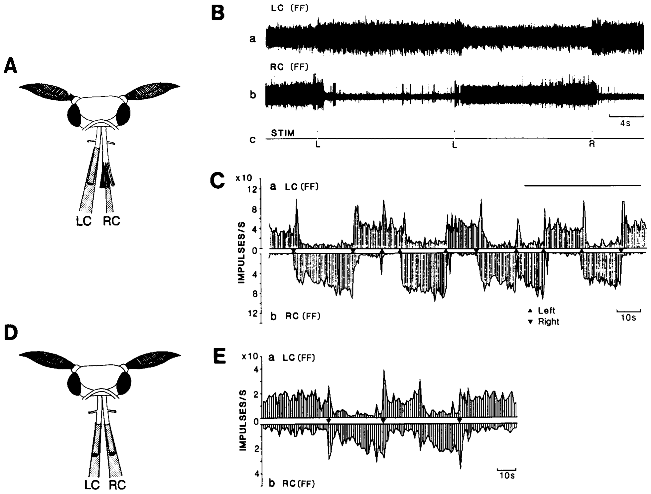
Descending activity can persist after an odor pulse
Kanzaki, Ikeda and Shibuya recorded activity from dorsal bundles of the neck connectives while delivering brief bombykol pulses. Anatomical staining identified descending neurons associated with the LAL. These recordings tested whether the motor pathway simply copied the brief duration of peripheral stimulation.
Some units switched between high- and low-frequency states after 100-ms odor pulses. The operational criterion required at least a doubling or halving of prestimulus firing that persisted for at least 5 s after stimulation ended. The response could therefore greatly outlast the input.
This flip-flopping activity is a persistent state change, rather than a new odor contact lasting several seconds. It is consistent with central maintenance of a searching command. Descending neurons therefore hold a state for seconds after a 100-ms input.
Kanzaki et al. (1994), Fig. 6(A–E). Descending-neuron locations and persistent pheromone responses.
Namiki et al. (2018), Fig. 2(a–d). Confocal anatomy of lateral accessory lobes and posterior slope.
Kanzaki et al. (1994); Namiki et al. (2018)
34
Notes:
• Kanzaki, Ikeda and Shibuya recorded activity from dorsal bundles of the neck connectives while delivering brief bombykol pulses. Anatomical staining identified descending neurons associated with the LAL. These recordings tested whether the motor pathway simply copied the brief duration of peripheral stimulation.
– A brief trigger and a maintained state have different time courses. Persistence permits the nervous system to continue responding during an interruption of odor contact.
• Some units switched between high- and low-frequency states after 100-ms odor pulses. The operational criterion required at least a doubling or halving of prestimulus firing that persisted for at least 5 s after stimulation ended. The response could therefore greatly outlast the input.
• This flip-flopping activity is a persistent state change, rather than a new odor contact lasting several seconds. It is consistent with central maintenance of a searching command. Descending neurons therefore hold a state for seconds after a 100-ms input.
References:
Kanzaki R, Ikeda A, Shibuya T (1994). Morphological and physiological properties of pheromone-triggered flipflopping descending interneurons of the male silkworm moth, Bombyx mori. Journal of Comparative Physiology A 175(1):1–14. https://doi.org/10.1007/bf00217431
Namiki S, Wada S, Kanzaki R (2018). Descending neurons from the lateral accessory lobe and posterior slope in the brain of the silkmoth Bombyx mori. Scientific Reports 8(1):9663. https://doi.org/10.1038/s41598-018-27954-5
Figure: Kanzaki et al. (1994), Fig. 6(A–E). Descending-neuron locations and persistent pheromone responses.
Figure source: https://doi.org/10.1007/bf00217431
Figure: Namiki et al. (2018), Fig. 2(a–d). Confocal anatomy of lateral accessory lobes and posterior slope.
Figure source: https://doi.org/10.1038/s41598-018-27954-5

Slide 46
A persistent state outlasts the stimulus
A persistent state is a pattern of neural activity that continues after the stimulus that triggered it has ended. The duration of the output is then set by the circuit and not by the duration of the input.
Kanzaki, Ikeda and Shibuya recorded dorsal bundles of the neck connectives while delivering 100-ms bombykol pulses. Some descending units switched between high- and low-frequency states. The criterion was at least a doubling or halving of prestimulus firing that persisted for at least 5 s.
The response could therefore greatly outlast the input. Descending activity does not simply copy the brief duration of peripheral stimulation, which is consistent with central maintenance of a searching command.
Kanzaki et al. (1994), Fig. 6(A–E). Descending-neuron locations and persistent pheromone responses.
Namiki et al. (2018), Fig. 2(a–d). Confocal anatomy of lateral accessory lobes and posterior slope.
Kanzaki et al. (1994); Namiki et al. (2018)
34a
Notes:
• Some descending neurons keep their state after the odor is gone.
• Definition.
– A persistent state continues after the triggering stimulus has ended.
– The circuit sets the duration of the output.
• Recording.
– Dorsal bundles of the neck connectives were recorded.
– Brief bombykol pulses lasted 100 milliseconds.
• Units.
– Some descending units switched between high- and low-frequency states.
• Criterion.
– Firing had to double or halve relative to the prestimulus level.
– The change had to persist for at least 5 seconds.
• Comparison.
– The response could greatly outlast the input.
– A 100-millisecond input produced seconds of output.
• Meaning.
– Descending activity does not copy the brief peripheral stimulus.
– Central maintenance of a searching command is consistent with the pattern.
• Anatomy.
– Staining identified descending neurons associated with the lateral accessory lobe.
– The recordings tested whether the motor pathway copies the stimulus duration.
• Descending neurons.
– Descending neurons send axons from the brain toward the ventral nervous system and thoracic motor centers.
– The recordings sampled those axons in the neck connectives.
• Pulse length.
– The stimulus lasted 100 milliseconds while the response lasted at least 5 seconds.
References:
Kanzaki R, Ikeda A, Shibuya T (1994). Morphological and physiological properties of pheromone-triggered flipflopping descending interneurons of the male silkworm moth, Bombyx mori. Journal of Comparative Physiology A 175(1):1–14. https://doi.org/10.1007/bf00217431
Namiki S, Wada S, Kanzaki R (2018). Descending neurons from the lateral accessory lobe and posterior slope in the brain of the silkmoth Bombyx mori. Scientific Reports 8(1):9663. https://doi.org/10.1038/s41598-018-27954-5

Slide 47
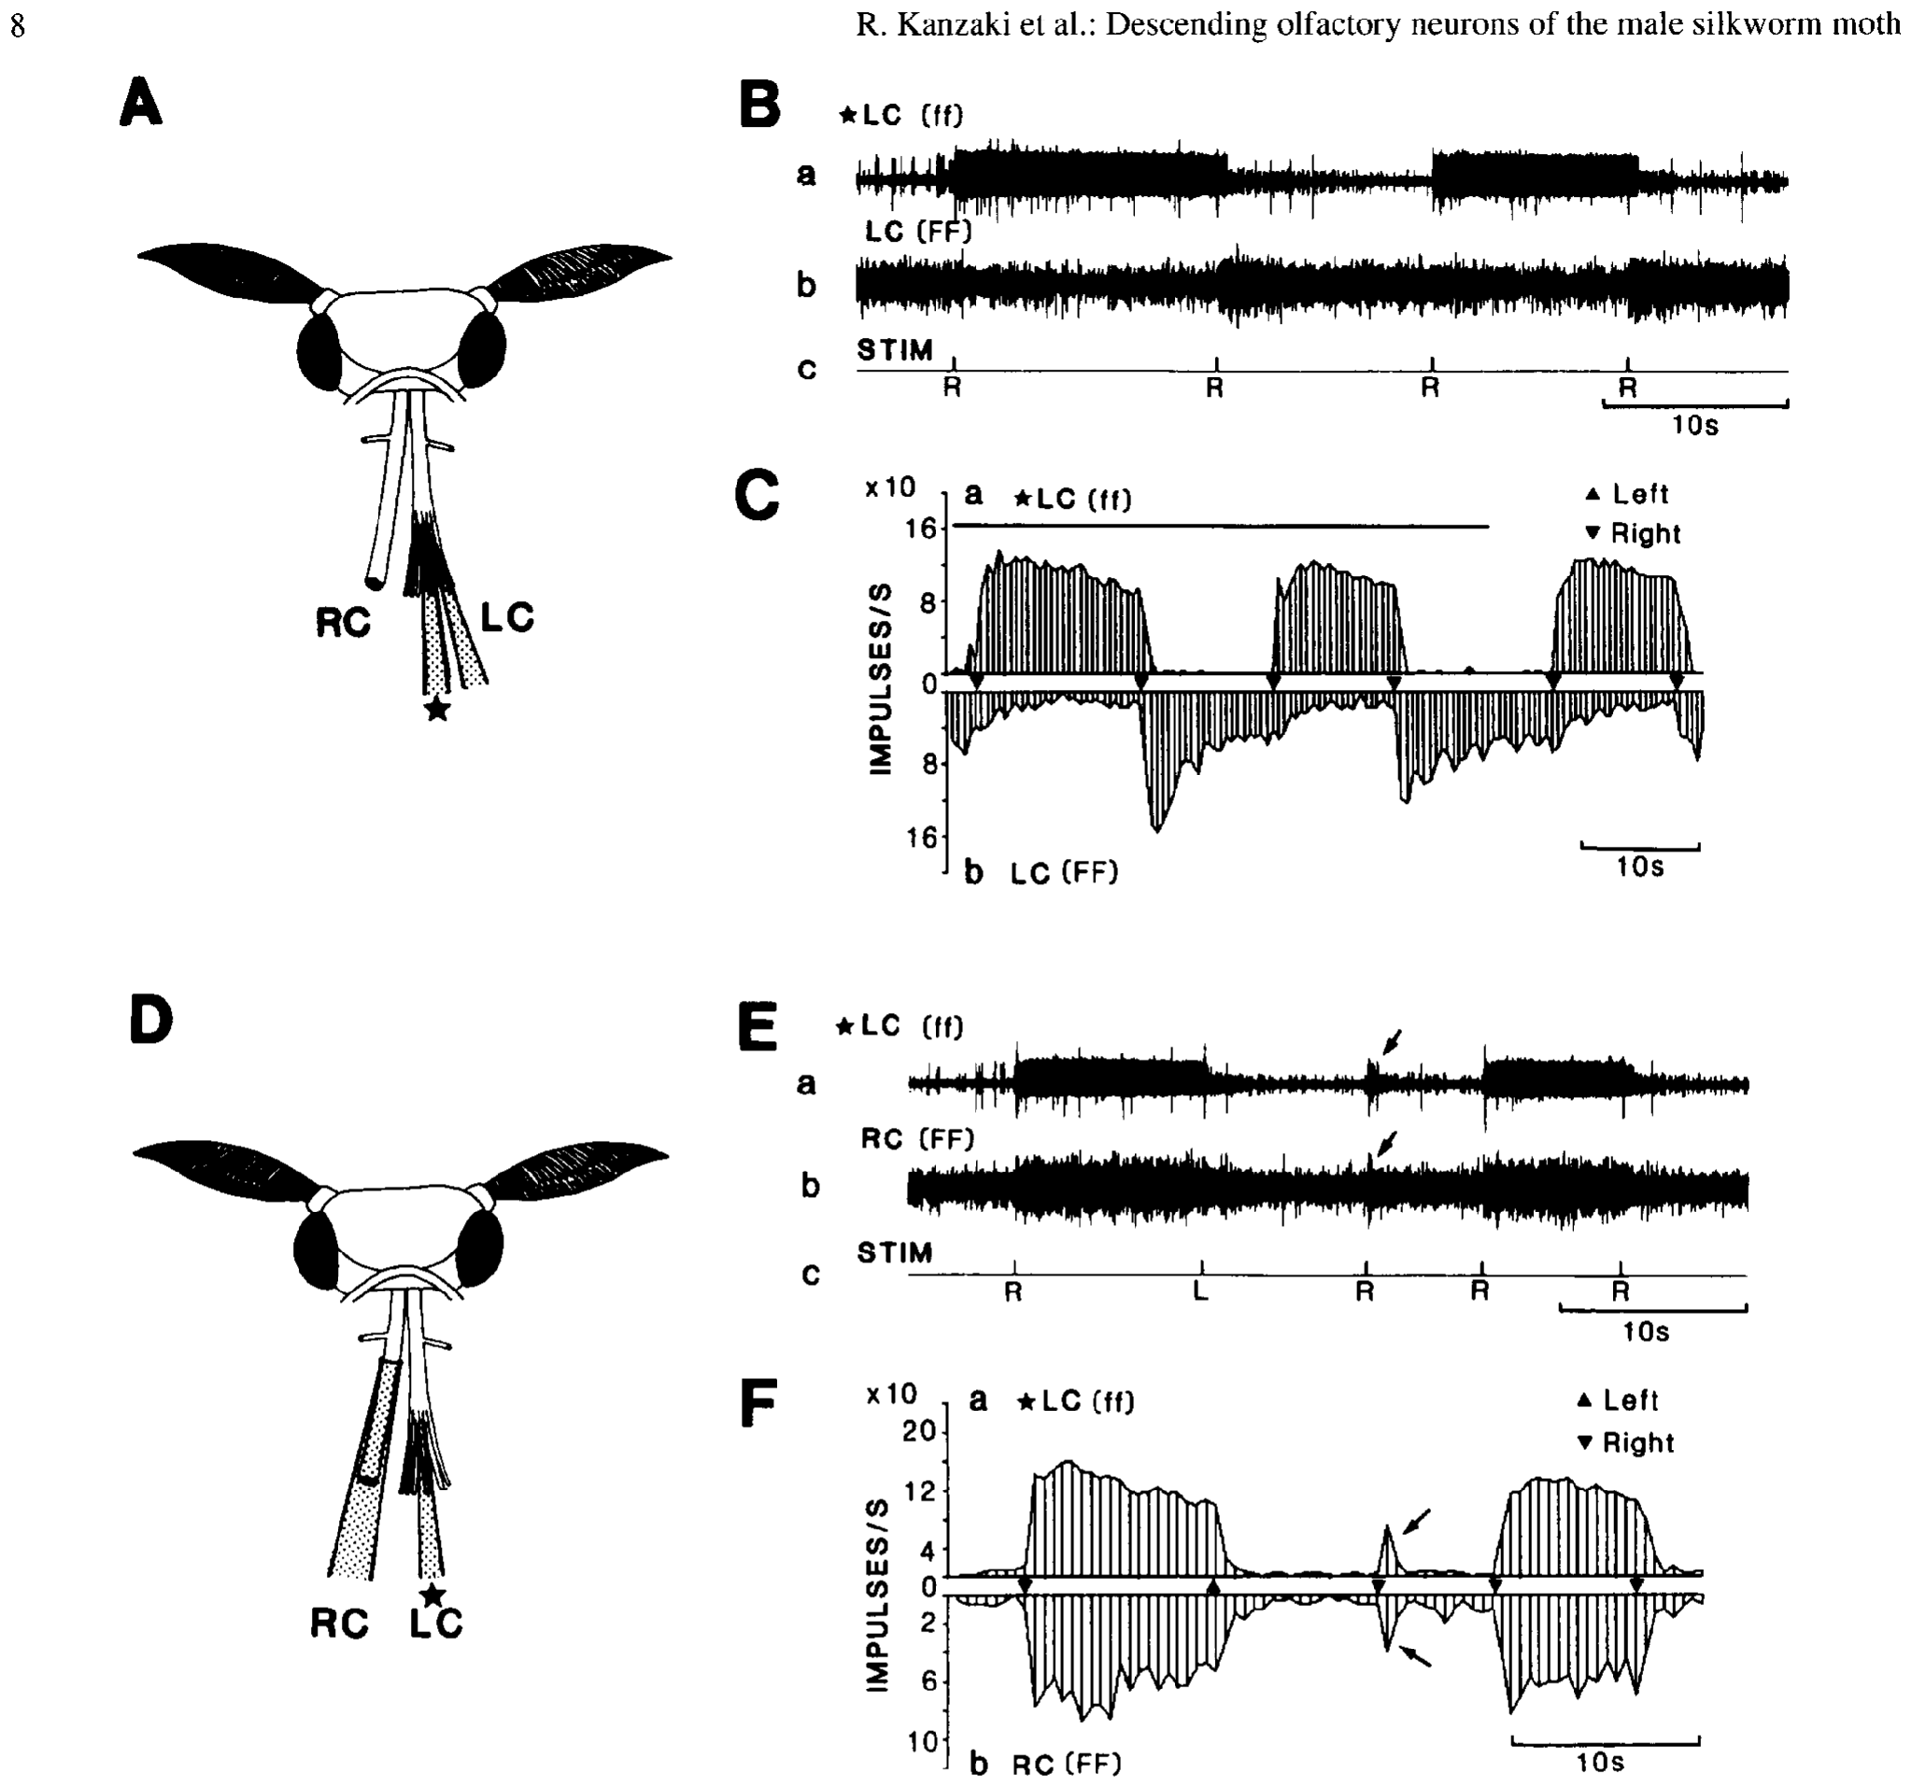
Later odor pulses can switch the persistent state
Kanzaki and colleagues applied successive pheromone pulses to one or both antennae while recording descending units. Some units alternated between high and low firing states rather than producing an identical transient response to every presentation. Spontaneous state changes also occurred after stimulation.
In one class, two recorded signals changed in synchrony; other recordings had an opposite relationship. The maintained activity could be interrupted or switched by a later pulse, so its duration was not determined solely by the duration of one sensory stimulus.
The findings support a state-dependent central transformation between odor contact and descending output. Later pulses can switch the maintained state, so descending output depends on the history of stimulation as well as the current stimulus.
Namiki et al. (2018), Fig. 2(a–d). Confocal anatomy of lateral accessory lobes and posterior slope.
Kanzaki et al. (1994), Fig. 7(A–F). Repeated pheromone stimulation changes descending activity state.
Kanzaki et al. (1994); Namiki et al. (2018)
35
Notes:
• Kanzaki and colleagues applied successive pheromone pulses to one or both antennae while recording descending units. Some units alternated between high and low firing states rather than producing an identical transient response to every presentation. Spontaneous state changes also occurred after stimulation.
– The same sensory event can have different effects depending on current activity. A neuron already in its high state need not respond as if it were initially silent.
• In one class, two recorded signals changed in synchrony; other recordings had an opposite relationship. The maintained activity could be interrupted or switched by a later pulse, so its duration was not determined solely by the duration of one sensory stimulus.
• The findings support a state-dependent central transformation between odor contact and descending output. Later pulses can switch the maintained state, so descending output depends on the history of stimulation as well as the current stimulus.
References:
Kanzaki R, Ikeda A, Shibuya T (1994). Morphological and physiological properties of pheromone-triggered flipflopping descending interneurons of the male silkworm moth, Bombyx mori. Journal of Comparative Physiology A 175(1):1–14. https://doi.org/10.1007/bf00217431
Namiki S, Wada S, Kanzaki R (2018). Descending neurons from the lateral accessory lobe and posterior slope in the brain of the silkmoth Bombyx mori. Scientific Reports 8(1):9663. https://doi.org/10.1038/s41598-018-27954-5
Figure: Kanzaki et al. (1994), Fig. 7(A–F). Repeated pheromone stimulation changes descending activity state.
Figure source: https://doi.org/10.1007/bf00217431
Figure: Namiki et al. (2018), Fig. 2(a–d). Confocal anatomy of lateral accessory lobes and posterior slope.
Figure source: https://doi.org/10.1038/s41598-018-27954-5

Slide 48
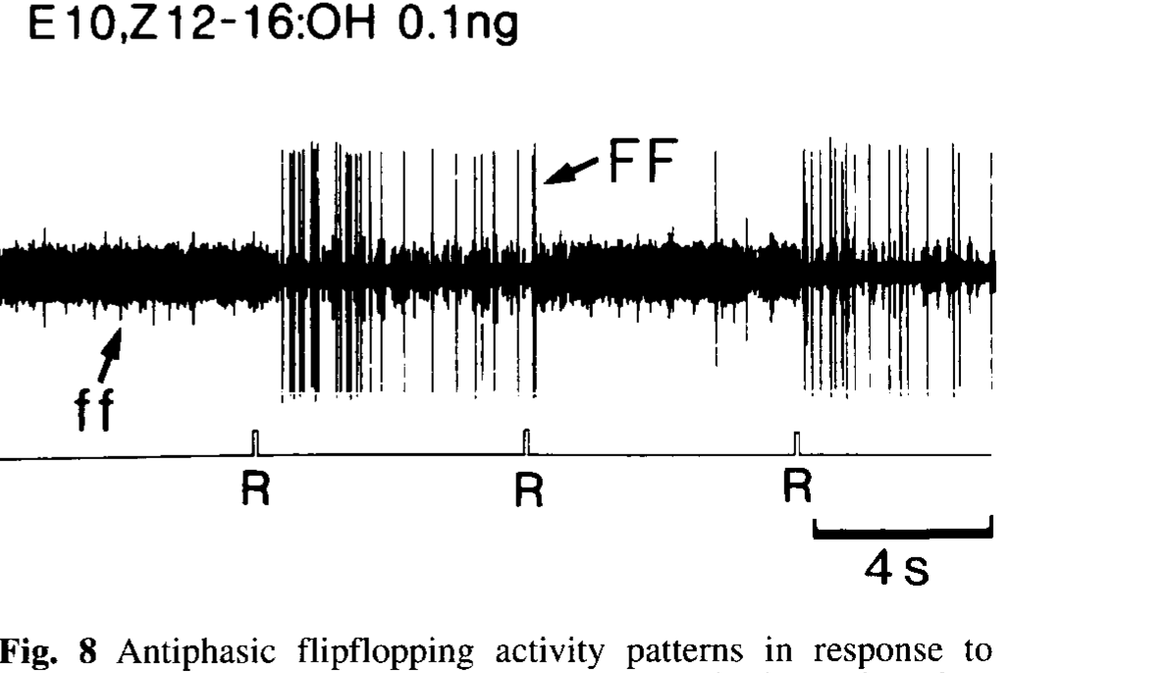
Descending signals include opposite activity states
Kanzaki and colleagues distinguished antiphasic activity, in which one signal was high while the other was low, from synchronized state changes. Bilateral connective recordings revealed opposite states across sides; a small-bundle recording also separated large and small impulses with opposite switching patterns.
The authors named the antiphasic class FF and the synchronized class ff. Both could change after brief pheromone stimulation. Thus, the descending pathway contained more than one relationship among persistent outputs rather than one uniform bilateral signal.
Opposite states across the two connectives are compatible with alternating directional commands during searching. The synchronized class shows that some persistent outputs change together, so the descending pathway carries both relationships.
Kanzaki et al. (1994), Fig. 8(single panel). Opposite switching states in units recorded from a descending bundle.
Namiki et al. (2018), Fig. 2(a–d). Confocal anatomy of lateral accessory lobes and posterior slope.
Kanzaki et al. (1994); Namiki et al. (2018)
36
Notes:
• Kanzaki and colleagues distinguished antiphasic activity, in which one signal was high while the other was low, from synchronized state changes. Bilateral connective recordings revealed opposite states across sides; a small-bundle recording also separated large and small impulses with opposite switching patterns.
– Antiphasic refers to the relationship between two signals. It does not require that either signal oscillate at a regular frequency or that the pair be directly connected.
• The authors named the antiphasic class FF and the synchronized class ff. Both could change after brief pheromone stimulation. Thus, the descending pathway contained more than one relationship among persistent outputs rather than one uniform bilateral signal.
• Opposite states across the two connectives are compatible with alternating directional commands during searching. The synchronized class shows that some persistent outputs change together, so the descending pathway carries both relationships.
References:
Kanzaki R, Ikeda A, Shibuya T (1994). Morphological and physiological properties of pheromone-triggered flipflopping descending interneurons of the male silkworm moth, Bombyx mori. Journal of Comparative Physiology A 175(1):1–14. https://doi.org/10.1007/bf00217431
Namiki S, Wada S, Kanzaki R (2018). Descending neurons from the lateral accessory lobe and posterior slope in the brain of the silkmoth Bombyx mori. Scientific Reports 8(1):9663. https://doi.org/10.1038/s41598-018-27954-5
Figure: Kanzaki et al. (1994), Fig. 8(single panel). Opposite switching states in units recorded from a descending bundle.
Figure source: https://doi.org/10.1007/bf00217431
Figure: Namiki et al. (2018), Fig. 2(a–d). Confocal anatomy of lateral accessory lobes and posterior slope.
Figure source: https://doi.org/10.1038/s41598-018-27954-5

Slide 49
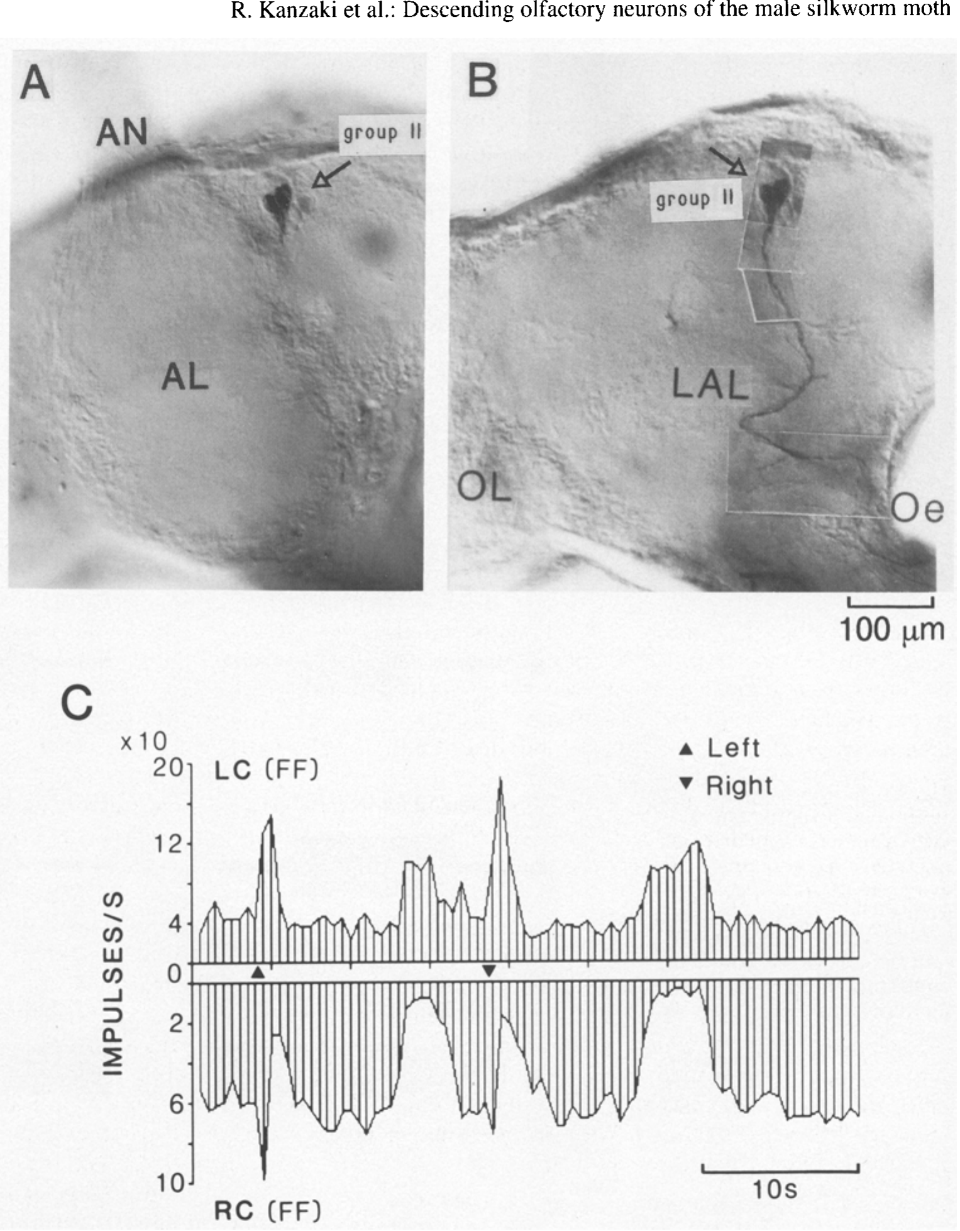
Cell staining constrains the source of switching
Kanzaki and colleagues combined electrophysiology with staining of a small descending bundle carrying FF-type activity. In the reported preparation, a single stained neuron had its cell body among group-II descending neurons and processes associated with the lateral accessory lobe.
The simultaneously recorded activity retained the opposite-state relationship with the other connective. The cell’s descending axon and regional innervation therefore connected anatomical identity to a persistent physiological response more specifically than a whole-connective recording alone.
This result supports participation of a group-II LAL descending neuron in the switching pathway. Its descending axon and LAL processes tie the opposite-state activity to an anatomically identified cell.
Kanzaki et al. (1994), Fig. 10(A–C). Stained group-II descending neuron and switching responses.
Kanzaki et al. (1994)
37
Notes:
• Kanzaki and colleagues combined electrophysiology with staining of a small descending bundle carrying FF-type activity. In the reported preparation, a single stained neuron had its cell body among group-II descending neurons and processes associated with the lateral accessory lobe.
– A labeled cell provides a candidate anatomical source of recorded activity. Establishing necessary or sufficient behavioral control would additionally require a selective intervention on that neuron.
• The simultaneously recorded activity retained the opposite-state relationship with the other connective. The cell’s descending axon and regional innervation therefore connected anatomical identity to a persistent physiological response more specifically than a whole-connective recording alone.
• This result supports participation of a group-II LAL descending neuron in the switching pathway. Its descending axon and LAL processes tie the opposite-state activity to an anatomically identified cell.
References:
Kanzaki R, Ikeda A, Shibuya T (1994). Morphological and physiological properties of pheromone-triggered flipflopping descending interneurons of the male silkworm moth, Bombyx mori. Journal of Comparative Physiology A 175(1):1–14. https://doi.org/10.1007/bf00217431
Figure: Kanzaki et al. (1994), Fig. 10(A–C). Stained group-II descending neuron and switching responses.
Figure source: https://doi.org/10.1007/bf00217431

Slide 50
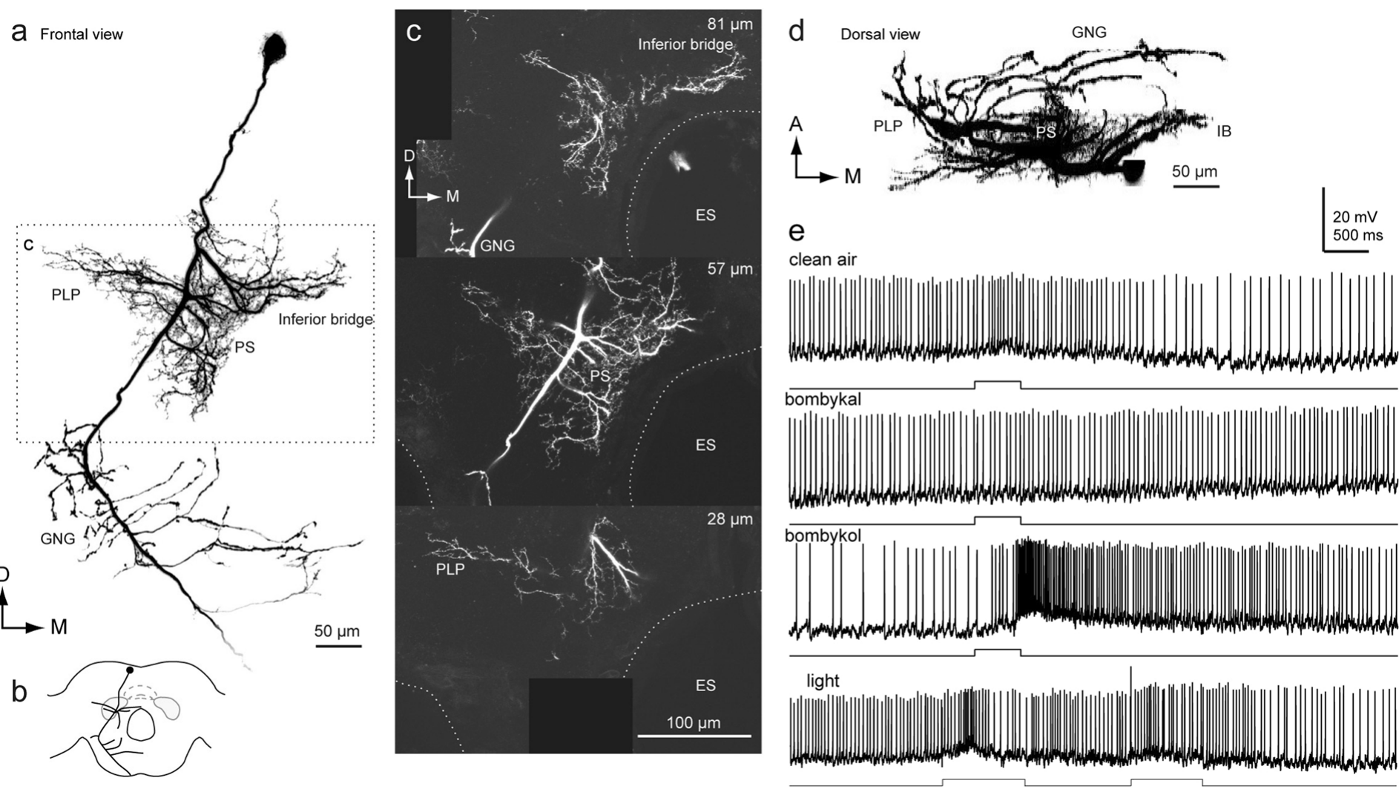
Posterior-slope neurons carry transient odor signals
Namiki and colleagues recorded and filled descending neurons whose processes entered the posterior slope. The group-III PSDN1 neuron had smooth processes in posterior brain regions and varicose processes in the gnathal ganglion, a lower central region associated with descending pathways. Its arborization places it among the routes that carry signals from the brain toward the motor systems, and its processes therefore link the posterior slope to downstream centers.
The identified cell responded to bombykol with excitation. The group-III neurons instead produced transient excitation without the characteristic flip-flop activity. This contrast separates a transient pheromone-responsive population from the persistent pathways associated with the lateral accessory lobe in earlier work. Each population contributes to the search with a different time course, so the two groups can be distinguished by how long their excitation lasts.
The authors proposed that transient group-III signals contribute to the initial surge, whereas persistent signals in other populations sustain casting. Surge and casting are therefore carried by populations with different time courses, one transient and one persistent, which organizes the search sequence. Shared sensory input therefore feeds populations that respond at different speeds, and the sequence of surge and casting depends on which population dominates at each moment of the search.
Namiki et al. (2018), Fig. 9(a–e). Posterior-slope descending-neuron anatomy and odor-evoked activity.
Namiki et al. (2018)
38
Notes:
• Namiki and colleagues recorded and filled descending neurons whose processes entered the posterior slope but not necessarily the lateral accessory lobe. The group-III PSDN1 neuron had smooth processes in posterior brain regions and varicose processes in the gnathal ganglion, a lower central region associated with descending pathways.
– Smooth and varicose processes are morphological features used to infer likely input and output regions. Light-microscopic shape does not establish the direction of every individual synapse.
• The identified cell responded to bombykol with excitation. The authors did not observe the characteristic flip-flop activity in the group-III neurons they examined. This distinguishes a transient pheromone-responsive population from the LAL-associated persistent pathways described in earlier work.
• The authors proposed that transient group-III signals might contribute to the initial surge, whereas persistent signals could contribute to casting. Surge and casting would then be carried by populations with different time courses, transient and persistent.
References:
Namiki S, Wada S, Kanzaki R (2018). Descending neurons from the lateral accessory lobe and posterior slope in the brain of the silkmoth Bombyx mori. Scientific Reports 8(1):9663. https://doi.org/10.1038/s41598-018-27954-5
Figure: Namiki et al. (2018), Fig. 9(a–e). Posterior-slope descending-neuron anatomy and odor-evoked activity.
Figure source: https://doi.org/10.1038/s41598-018-27954-5

Slide 51
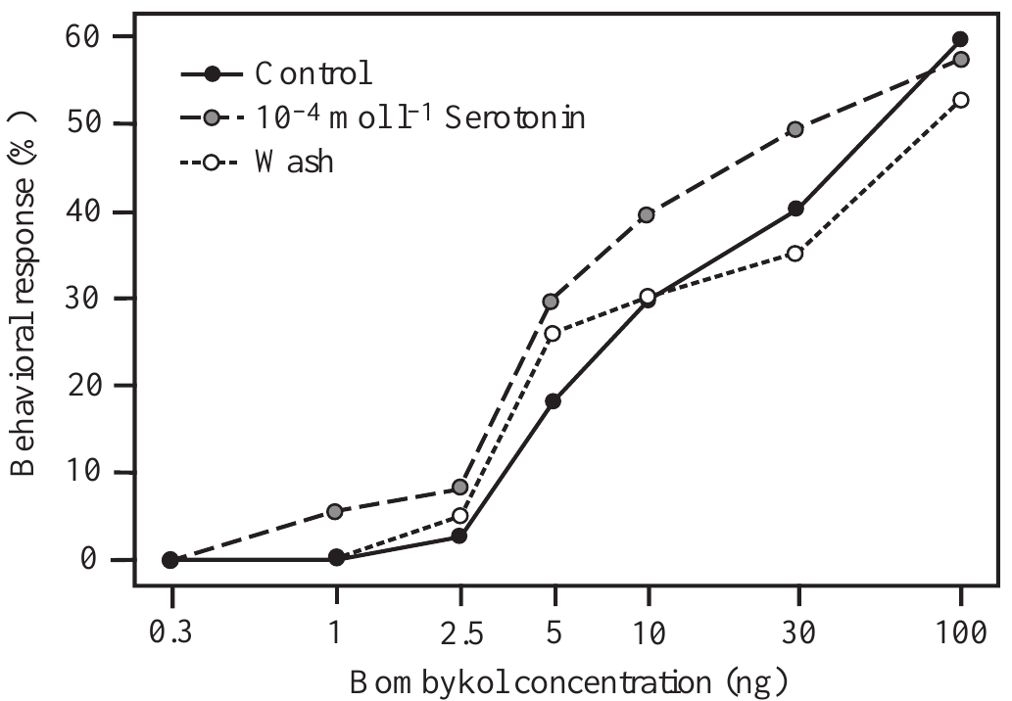
Serotonin changes behavioral pheromone sensitivity
Serotonin, also called 5-hydroxytryptamine, is a neurotransmitter and neuromodulator that can change a circuit’s responsiveness. Gatellier and colleagues applied it to exposed silkmoth antennal lobes and measured male responses to increasing bombykol source loads. Saline tests before treatment and a later wash supplied comparisons.
At 10⁻⁴ mol/L, serotonin increased behavioral sensitivity. For 5 ng bombykol, the response fraction rose from 18% in the control condition to 30% during treatment. The dose-response curve returned toward the control condition after 24 h.
The effect connects a central chemical manipulation to altered behavioral initiation. Serotonin therefore lowers the dose of bombykol needed to initiate searching, as a modulator of a circuit already activated by pheromone.
Gatellier et al. (2004), Fig. 2(single panel). Pheromone response curve before serotonin, during treatment and after wash.
Tabuchi et al. (2013), Fig. 1(C). Bombykol sensory axons terminate in the toroid.
Gatellier et al. (2004); Tabuchi et al. (2013)
39
Notes:
• Serotonin, also called 5-hydroxytryptamine, is a neurotransmitter and neuromodulator that can change a circuit’s responsiveness. Gatellier and colleagues applied it to exposed silkmoth antennal lobes and measured male responses to increasing bombykol source loads. Saline tests before treatment and a later wash supplied comparisons.
– A neuromodulator changes how a circuit responds to another input. Here the initiating sensory signal remained bombykol, while serotonin altered the likelihood of responding.
• At 10⁻⁴ mol/L, serotonin increased behavioral sensitivity. For 5 ng bombykol, the response fraction rose from 18% in the control condition to 30% during treatment. The dose-response curve returned toward the control condition after 24 h.
• The effect connects a central chemical manipulation to altered behavioral initiation. Serotonin therefore lowers the dose of bombykol needed to initiate searching, as a modulator of a circuit already activated by pheromone.
References:
Gatellier L, Nagao T, Kanzaki R (2004). Serotonin modifies the sensitivity of the male silkmoth to pheromone. Journal of Experimental Biology 207(14):2487-2496. https://doi.org/10.1242/jeb.01035
Tabuchi M, Sakurai T, Mitsuno H, Namiki S, Minegishi R, Shiotsuki T, Uchino K, Sezutsu H, Tamura T, Haupt SS, Nakatani K, Kanzaki R (2013). Pheromone responsiveness threshold depends on temporal integration by antennal lobe projection neurons. Proceedings of the National Academy of Sciences 110(38):15455-15460. https://doi.org/10.1073/pnas.1313707110
Figure: Gatellier et al. (2004), Fig. 2(single panel). Pheromone response curve before serotonin, during treatment and after wash.
Figure source: https://doi.org/10.1242/jeb.01035
Figure: Tabuchi et al. (2013), Fig. 1(C). Bombykol sensory axons terminate in the toroid.
Figure source: https://doi.org/10.1073/pnas.1313707110

Slide 52
A dose-response curve relates dose to response
A dose-response curve plots the fraction of animals that respond against the amount of stimulus delivered. A curve that shifts to the left means that a smaller dose is sufficient, and a shift to the right means that a larger dose is required.
Gatellier and colleagues tested male responses to increasing bombykol source loads on exposed silkmoth antennal lobes after saline, and again after serotonin at 10⁻⁴ mol/L. For 5 ng bombykol, the response fraction rose from 18% in the control condition to 30% during treatment.
The curve returned toward the control condition after 24 h, so the change was reversible. Serotonin therefore changed behavioral sensitivity to pheromone without replacing the pheromone as the stimulus.
Gatellier et al. (2004), Fig. 2(single panel). Pheromone response curve before serotonin, during treatment and after wash.
Tabuchi et al. (2013), Fig. 1(C). Bombykol sensory axons terminate in the toroid.
Gatellier et al. (2004); Tabuchi et al. (2013)
39a
Notes:
• A dose-response curve summarizes sensitivity across many doses.
• Definition.
– The curve plots the fraction of animals that respond against stimulus dose.
• Direction of shifts.
– A leftward shift means that a smaller dose is sufficient.
– A rightward shift means that a larger dose is required.
• Experiment.
– Males were tested with increasing bombykol source loads.
– Saline tests before treatment and a later wash supplied comparisons.
• Result.
– Serotonin at 10 to the minus 4 mol per liter increased sensitivity.
– At 5 nanograms the response fraction rose from 18 to 30 percent.
• Recovery.
– The curve returned toward the control condition after 24 hours.
• Meaning.
– Serotonin changes sensitivity and does not replace the pheromone as the stimulus.
• Application.
– Serotonin was applied to exposed antennal lobes.
– The concentration was 10 to the minus 4 mol per liter.
• Timing of tests.
– Saline tests before treatment and a later wash supplied comparisons.
• Serotonin.
– Serotonin is a neurotransmitter and neuromodulator.
– It can change the responsiveness of a circuit.
• Numbers.
– At 5 nanograms of bombykol the response fraction rose from 18 to 30 percent.
References:
Gatellier L, Nagao T, Kanzaki R (2004). Serotonin modifies the sensitivity of the male silkmoth to pheromone. Journal of Experimental Biology 207(14):2487-2496. https://doi.org/10.1242/jeb.01035

Slide 53
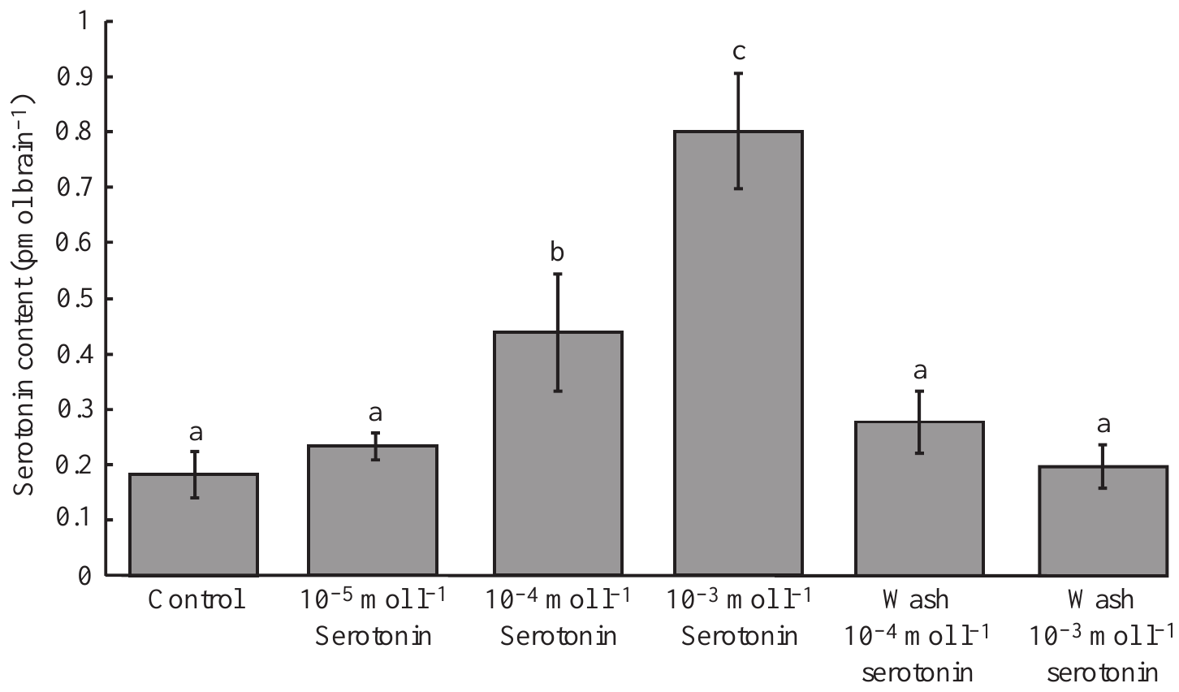
Serotonin has concentration-dependent effects
Gatellier and colleagues compared serotonin applications of 10⁻⁵, 10⁻⁴ and 10⁻³ mol/L. The lowest concentration did not appreciably change behavioral sensitivity, the intermediate concentration enhanced it, and the highest concentration reduced it. More serotonin therefore did not produce a monotonic increase in responsiveness.
High-performance liquid chromatography, or HPLC, separated serotonin from other tissue compounds for electrochemical measurement. Brain content rose from about 0.18 pmol/brain in controls to 0.44 and 0.80 pmol/brain after the intermediate and high applications. After 24 h, content returned toward control levels.
These measurements verify that application changed tissue serotonin while revealing opposite behavioral outcomes. Intermediate serotonin enhances responsiveness and high serotonin reduces it, so the effect rises and then falls with dose and is not a simple excitatory one.
Gatellier et al. (2004), Fig. 4(single panel). Measured brain serotonin after application and wash.
Tabuchi et al. (2013), Fig. 1(C). Bombykol sensory axons terminate in the toroid.
Gatellier et al. (2004); Tabuchi et al. (2013)
40
Notes:
• Gatellier and colleagues compared serotonin applications of 10⁻⁵, 10⁻⁴ and 10⁻³ mol/L. The lowest concentration did not appreciably change behavioral sensitivity, the intermediate concentration enhanced it, and the highest concentration reduced it. More serotonin therefore did not produce a monotonic increase in responsiveness.
– A picomole is one trillionth of a mole. Tissue content measures total recovered material and differs from the applied solution’s concentration.
• High-performance liquid chromatography, or HPLC, separated serotonin from other tissue compounds for electrochemical measurement. Brain content rose from about 0.18 pmol/brain in controls to 0.44 and 0.80 pmol/brain after the intermediate and high applications. After 24 h, content returned toward control levels.
• These measurements verify that application changed tissue serotonin while revealing opposite behavioral outcomes. Intermediate serotonin enhances responsiveness and high serotonin reduces it, so the effect rises and then falls with dose and is not a simple excitatory one.
References:
Gatellier L, Nagao T, Kanzaki R (2004). Serotonin modifies the sensitivity of the male silkmoth to pheromone. Journal of Experimental Biology 207(14):2487-2496. https://doi.org/10.1242/jeb.01035
Tabuchi M, Sakurai T, Mitsuno H, Namiki S, Minegishi R, Shiotsuki T, Uchino K, Sezutsu H, Tamura T, Haupt SS, Nakatani K, Kanzaki R (2013). Pheromone responsiveness threshold depends on temporal integration by antennal lobe projection neurons. Proceedings of the National Academy of Sciences 110(38):15455-15460. https://doi.org/10.1073/pnas.1313707110
Figure: Gatellier et al. (2004), Fig. 4(single panel). Measured brain serotonin after application and wash.
Figure source: https://doi.org/10.1242/jeb.01035
Figure: Tabuchi et al. (2013), Fig. 1(C). Bombykol sensory axons terminate in the toroid.
Figure source: https://doi.org/10.1073/pnas.1313707110

Slide 54
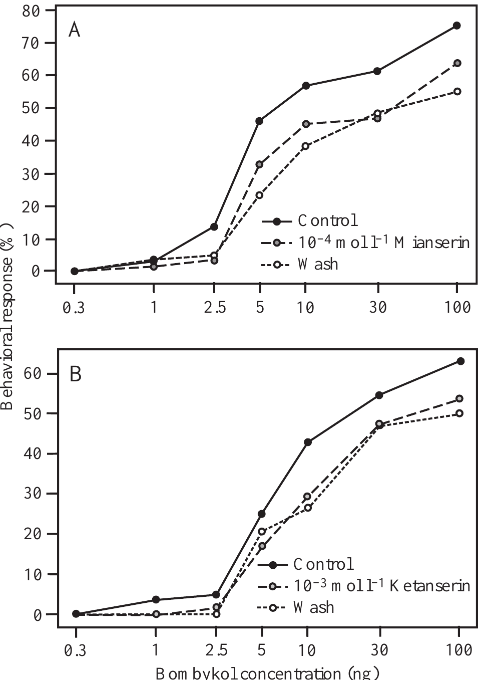
Antagonists reduce pheromone responsiveness
Gatellier and colleagues applied the serotonin antagonists mianserin and ketanserin to the exposed brain before bombykol testing. Mianserin at 10⁻⁴ mol/L and ketanserin at 10⁻³ mol/L shifted behavioral responsiveness toward higher required pheromone doses.
For 5 ng bombykol, mianserin reduced the response fraction from 46% to 33% in its comparison group. Ketanserin reduced it from 25% to 17% in a separate group. Ketanserin at 10⁻⁴ mol/L did not produce the same inhibitory effect.
Blocking serotonin receptors shifts behavior toward higher required pheromone doses, the opposite of the effect of applied serotonin, which supports serotonergic involvement in behavioral sensitivity.
Tabuchi et al. (2013), Fig. 1(C). Bombykol sensory axons terminate in the toroid.
Gatellier et al. (2004), Fig. 5(A–B). Serotonin antagonists decrease behavioral sensitivity to bombykol.
Gatellier et al. (2004); Tabuchi et al. (2013)
41
Notes:
• Gatellier and colleagues applied the serotonin antagonists mianserin and ketanserin to the exposed brain before bombykol testing. Mianserin at 10⁻⁴ mol/L and ketanserin at 10⁻³ mol/L shifted behavioral responsiveness toward higher required pheromone doses.
– The authors noted possible actions beyond the intended receptor classes. Pharmacological specificity must be established before an antagonist is treated as a selective deletion of one neural pathway.
• For 5 ng bombykol, mianserin reduced the response fraction from 46% to 33% in its comparison group. Ketanserin reduced it from 25% to 17% in a separate group. Ketanserin at 10⁻⁴ mol/L did not produce the same inhibitory effect.
• Blocking serotonin receptors shifts behavior toward higher required pheromone doses, the opposite of the effect of applied serotonin, which supports serotonergic involvement in behavioral sensitivity.
References:
Gatellier L, Nagao T, Kanzaki R (2004). Serotonin modifies the sensitivity of the male silkmoth to pheromone. Journal of Experimental Biology 207(14):2487-2496. https://doi.org/10.1242/jeb.01035
Tabuchi M, Sakurai T, Mitsuno H, Namiki S, Minegishi R, Shiotsuki T, Uchino K, Sezutsu H, Tamura T, Haupt SS, Nakatani K, Kanzaki R (2013). Pheromone responsiveness threshold depends on temporal integration by antennal lobe projection neurons. Proceedings of the National Academy of Sciences 110(38):15455-15460. https://doi.org/10.1073/pnas.1313707110
Figure: Gatellier et al. (2004), Fig. 5(A–B). Serotonin antagonists decrease behavioral sensitivity to bombykol.
Figure source: https://doi.org/10.1242/jeb.01035
Figure: Tabuchi et al. (2013), Fig. 1(C). Bombykol sensory axons terminate in the toroid.
Figure source: https://doi.org/10.1073/pnas.1313707110

Slide 55
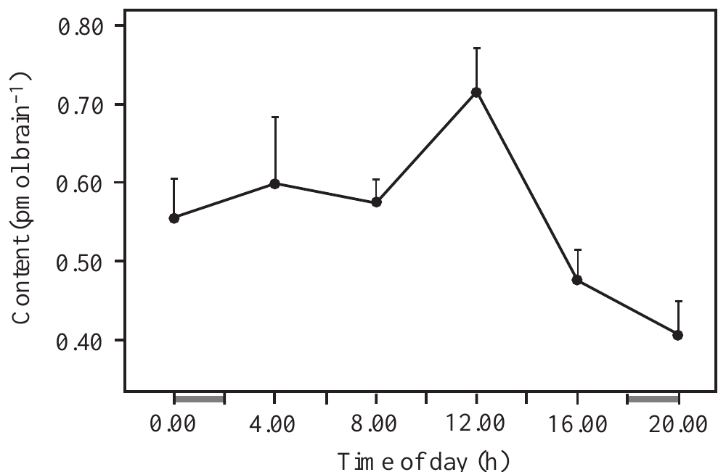
Daily serotonin variation accompanies sensitivity
Gatellier and colleagues measured brain serotonin every 4 h over a 24-h light–dark cycle and tested pheromone responsiveness at multiple times. Serotonin content peaked around noon at about 0.72 pmol/brain and declined to about 0.41 pmol/brain two hours after darkness began.
For 1 ng bombykol, behavioral responsiveness rose from 32% at 06:00 to 63% around noon, then declined to 16% at 22:00. Brain serotonin and response sensitivity therefore varied together over the tested daily schedule.
Brain serotonin and pheromone responsiveness peak together around noon and fall after darkness begins, consistent with a state-dependent serotonergic contribution. Application, antagonist and daily-cycle experiments therefore converge on serotonin as a modulator of sensitivity.
Gatellier et al. (2004), Fig. 7(single panel). Brain serotonin content varies with time of day.
Tabuchi et al. (2013), Fig. 1(C). Bombykol sensory axons terminate in the toroid.
Gatellier et al. (2004); Tabuchi et al. (2013)
42
Notes:
• Gatellier and colleagues measured brain serotonin every 4 h over a 24-h light–dark cycle and tested pheromone responsiveness at multiple times. Serotonin content peaked around noon at about 0.72 pmol/brain and declined to about 0.41 pmol/brain two hours after darkness began.
– An endogenous circadian rhythm continues without repeated external time cues. A daily pattern measured under scheduled light and darkness requires additional tests before that stronger claim can be made.
• For 1 ng bombykol, behavioral responsiveness rose from 32% at 06:00 to 63% around noon, then declined to 16% at 22:00. Brain serotonin and response sensitivity therefore varied together over the tested daily schedule.
• Brain serotonin and pheromone responsiveness peak together around noon and fall after darkness begins, consistent with a state-dependent serotonergic contribution. Application, antagonist and daily-cycle experiments therefore converge on serotonin as a modulator of sensitivity.
References:
Gatellier L, Nagao T, Kanzaki R (2004). Serotonin modifies the sensitivity of the male silkmoth to pheromone. Journal of Experimental Biology 207(14):2487-2496. https://doi.org/10.1242/jeb.01035
Tabuchi M, Sakurai T, Mitsuno H, Namiki S, Minegishi R, Shiotsuki T, Uchino K, Sezutsu H, Tamura T, Haupt SS, Nakatani K, Kanzaki R (2013). Pheromone responsiveness threshold depends on temporal integration by antennal lobe projection neurons. Proceedings of the National Academy of Sciences 110(38):15455-15460. https://doi.org/10.1073/pnas.1313707110
Figure: Gatellier et al. (2004), Fig. 7(single panel). Brain serotonin content varies with time of day.
Figure source: https://doi.org/10.1242/jeb.01035
Figure: Tabuchi et al. (2013), Fig. 1(C). Bombykol sensory axons terminate in the toroid.
Figure source: https://doi.org/10.1073/pnas.1313707110

Slide 56
Response fraction measures behavioral sensitivity
The response fraction is the proportion of tested males that perform the pheromone-searching behavior at a given bombykol dose. It measures behavioral sensitivity, because a higher fraction at the same dose means that the animals are more easily triggered.
Gatellier and colleagues measured brain serotonin every 4 h over a 24-h light–dark cycle. For 1 ng bombykol, responsiveness rose from 32% at 06:00 to 63% around noon, then declined to 16% at 22:00. Serotonin peaked around noon at about 0.72 pmol/brain.
Brain serotonin and response sensitivity therefore varied together over the tested daily schedule. Serotonin content declined to about 0.41 pmol/brain two hours after darkness began, in step with the fall in behavioral responsiveness.
Gatellier et al. (2004), Fig. 7(single panel). Brain serotonin content varies with time of day.
Tabuchi et al. (2013), Fig. 1(C). Bombykol sensory axons terminate in the toroid.
Gatellier et al. (2004); Tabuchi et al. (2013)
42a
Notes:
• A single proportion can track how sensitive the animals are at a given time.
• Definition.
– The response fraction is the proportion of tested males that perform the searching behavior at a given dose.
• Interpretation.
– A higher fraction at the same dose means the animals are more easily triggered.
• Design.
– Brain serotonin was measured every 4 hours over a 24-hour light and dark cycle.
– Pheromone responsiveness was tested at multiple times.
• Behavior.
– For 1 nanogram of bombykol, responsiveness was 32 percent at 06:00.
– It reached 63 percent around noon and fell to 16 percent at 22:00.
• Serotonin.
– Content peaked around noon at about 0.72 picomoles per brain.
– It declined to about 0.41 two hours after darkness began.
• Meaning.
– Serotonin and sensitivity varied together over the daily schedule.
• Why several times.
– Testing at multiple times of day shows how sensitivity changes along the cycle.
– Measurements were taken under a light and dark cycle.
• Dose.
– The behavioral test used 1 nanogram of bombykol.
References:
Gatellier L, Nagao T, Kanzaki R (2004). Serotonin modifies the sensitivity of the male silkmoth to pheromone. Journal of Experimental Biology 207(14):2487-2496. https://doi.org/10.1242/jeb.01035

Slide 57
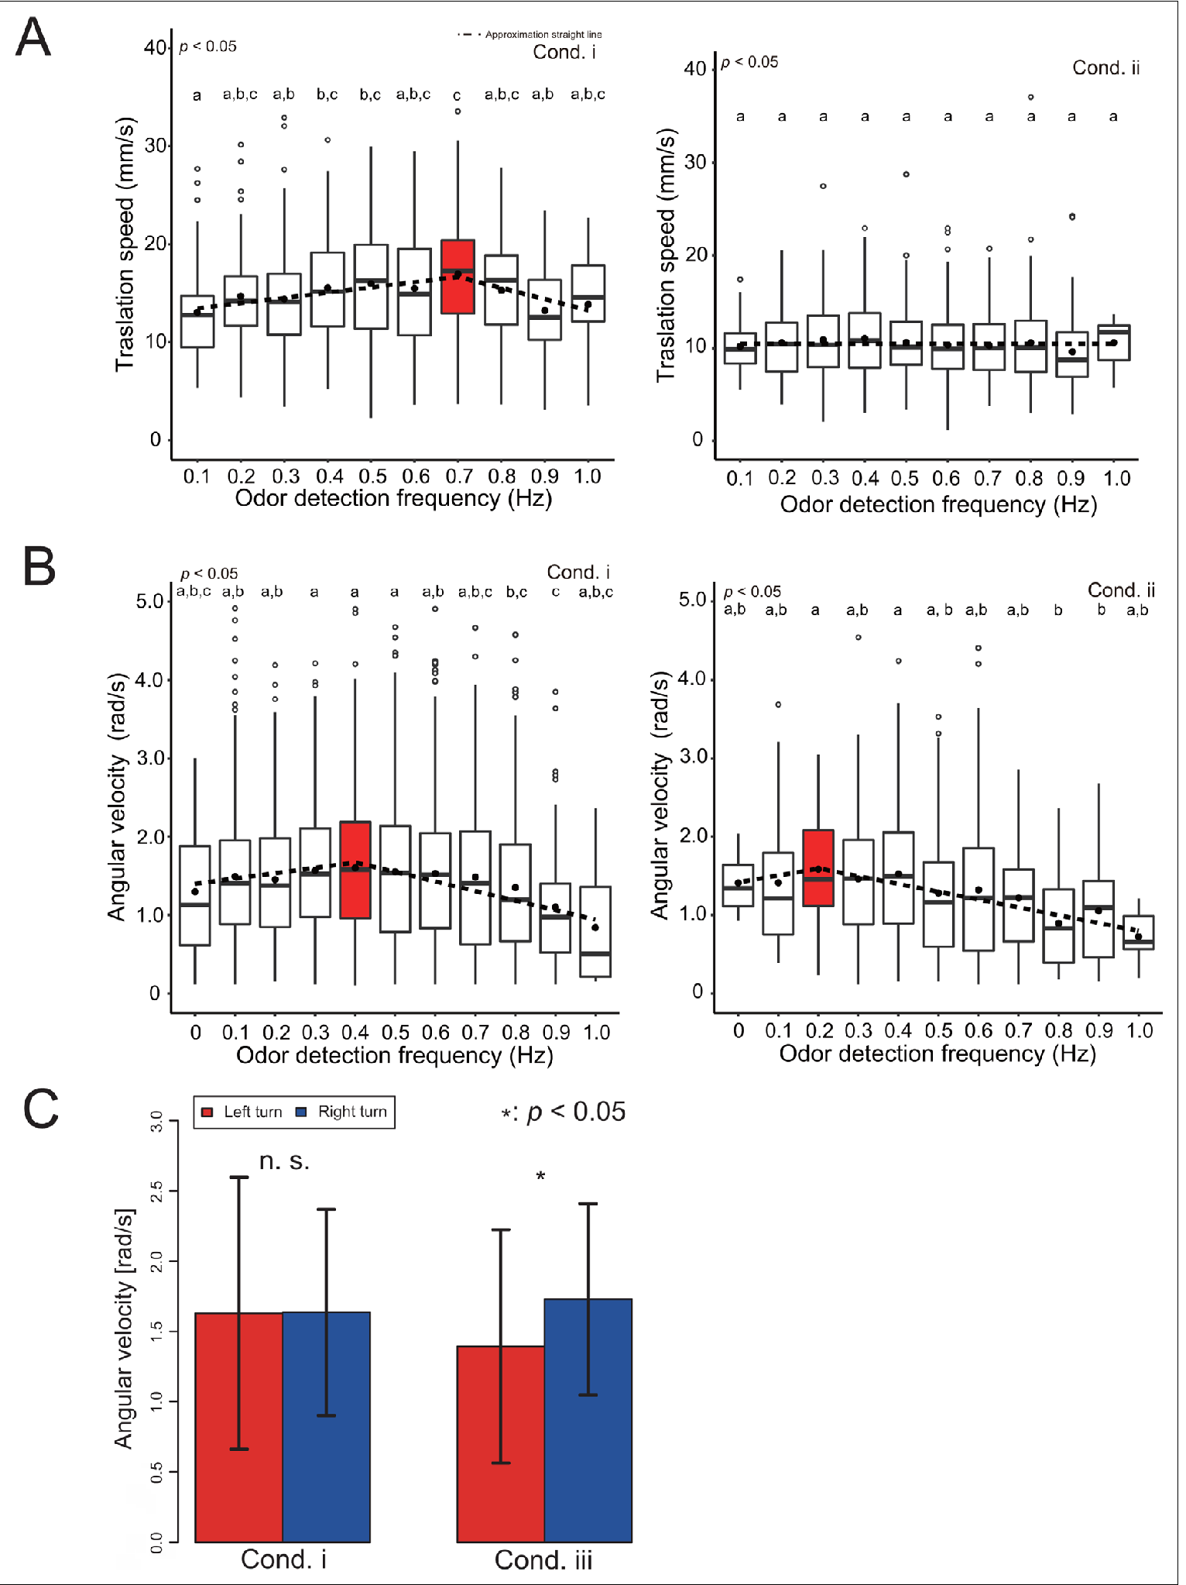
Sensory context changes walking speed and turning
Yamada and colleagues measured forward and angular velocity as a function of odor-detection frequency during virtual navigation. Angular velocity is the rate of change of heading, distinct from translational movement through space. Wind and optic-flow direction could be reversed independently.
With correctly aligned cues, forward velocity peaked around 0.7 Hz and turning velocity around 0.4 Hz. Reversing wind removed the same frequency-dependent forward-speed pattern and shifted the turning peak toward about 0.2 Hz. Reversing visual motion also produced unequal left- and right-turning responses.
These behavioral changes establish context-dependent control rather than a fixed response to odor frequency alone. Forward speed and turning peak at different frequencies, so wind and visual direction reshape how odor-contact rate drives walking.
Yamada et al. (2021), Fig. 5(A–C). Measured speed and turning changes with odor frequency and cue reversals.
Yamada et al. (2021)
43
Notes:
• Yamada and colleagues measured forward and angular velocity as a function of odor-detection frequency during virtual navigation. Angular velocity is the rate of change of heading, distinct from translational movement through space. Wind and optic-flow direction could be reversed independently.
– Frequency depends on the transported plume and the animal’s movement. An encounter rate cannot be treated as an invariant chemical distance ruler across environments.
• With correctly aligned cues, forward velocity peaked around 0.7 Hz and turning velocity around 0.4 Hz. Reversing wind removed the same frequency-dependent forward-speed pattern and shifted the turning peak toward about 0.2 Hz. Reversing visual motion also produced unequal left- and right-turning responses.
• These behavioral changes establish context-dependent control rather than a fixed response to odor frequency alone. Forward speed and turning peak at different frequencies, so wind and visual direction reshape how odor-contact rate drives walking.
References:
Yamada M, Ohashi H, Hosoda K, Kurabayashi D, Shigaki S (2021). Multisensory-motor integration in olfactory navigation of silkmoth, Bombyx mori, using virtual reality system. eLife 10:e72001. https://doi.org/10.7554/elife.72001
Figure: Yamada et al. (2021), Fig. 5(A–C). Measured speed and turning changes with odor frequency and cue reversals.
Figure source: https://doi.org/10.7554/elife.72001

Slide 58
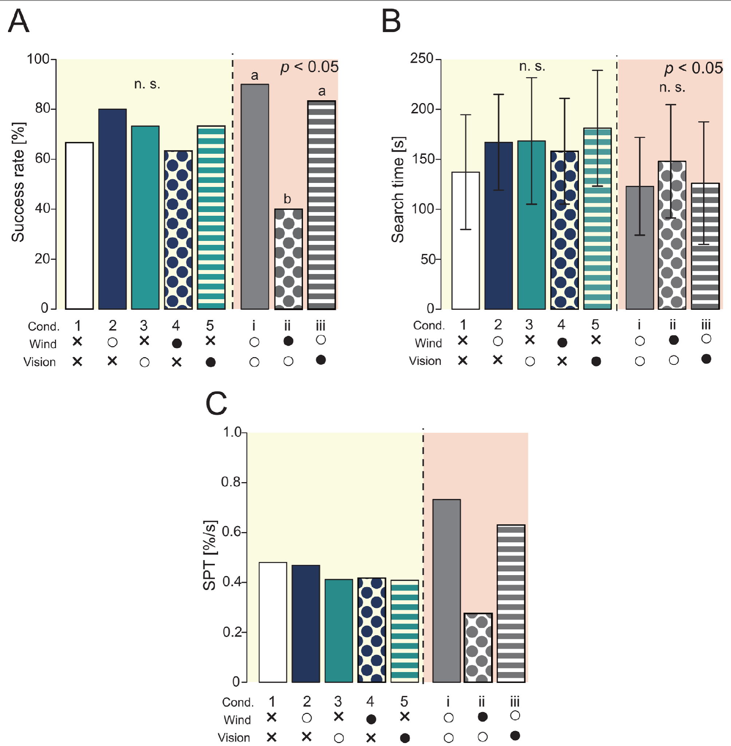
Aligned sensory cues improve source-finding success
Yamada and colleagues compared search success, arrival time and success per unit time across combinations of odor, wind and visual input. All treatments retained odor information, allowing the contributions of other cues to be evaluated against an odor-only condition.
Correctly aligned odor, wind and visual information improved performance compared with reduced-cue conditions. Reversing wind within the full-cue preparation sharply reduced success. Visual effects were context dependent: limited effects with odor alone did not mean vision was irrelevant when all three modalities were present.
The results support multisensory control of walking odor-source search. Aligned wind and visual information add to odor, and reversing wind removes the benefit.
Yamada et al. (2021), Fig. 4(A–C). Source-finding success, time and performance across sensory conditions.
Yamada et al. (2021)
44
Notes:
• Yamada and colleagues compared search success, arrival time and success per unit time across combinations of odor, wind and visual input. All treatments retained odor information, allowing the contributions of other cues to be evaluated against an odor-only condition.
– A behavioral improvement under combined cues need not arise from one anatomical convergence point. Several processing stages could contribute to the performance difference.
• Correctly aligned odor, wind and visual information improved performance compared with reduced-cue conditions. Reversing wind within the full-cue preparation sharply reduced success. Visual effects were context dependent: limited effects with odor alone did not mean vision was irrelevant when all three modalities were present.
• The results support multisensory control of walking odor-source search. Aligned wind and visual information add to odor, and reversing wind removes the benefit.
References:
Yamada M, Ohashi H, Hosoda K, Kurabayashi D, Shigaki S (2021). Multisensory-motor integration in olfactory navigation of silkmoth, Bombyx mori, using virtual reality system. eLife 10:e72001. https://doi.org/10.7554/elife.72001
Figure: Yamada et al. (2021), Fig. 4(A–C). Source-finding success, time and performance across sensory conditions.
Figure source: https://doi.org/10.7554/elife.72001

Slide 59
Tracking requires detection, timing and motor state
Published silkmoth experiments link several transformations: ligand-selective receptors excite a defined sensory channel; peripheral binding-protein function helps responses terminate; and antennal-lobe neurons combine or separate contacts according to input strength. These are experimentally distinguishable operations rather than one generic measure of olfactory sensitivity.
BmPBP1 loss preserves searching but reduces its temporal efficiency. Optogenetic paired inputs reveal central integration within tens of milliseconds, while descending recordings reveal states lasting seconds after brief stimulation. The different timescales permit short odor encounters to influence extended motor behavior.
Receptor identity, peripheral termination, central integration and persistent descending states form successive stages between bombykol binding and walking. Natural searching combines these sensory and central operations with wind and visual information.
Fujiwara et al. (2014), Fig. 2(A–G). Antennal-lobe anatomy and responses to repeated odor pulses.
Shiota et al. (2021), Fig. 4(A–E). Surge and turning behavior after pheromone-binding-protein loss.
Fujiwara et al. (2014); Shiota et al. (2021); Tabuchi et al. (2013); Kanzaki et al. (1994); Yamada et al. (2021)
45
Notes:
• Published silkmoth experiments link several transformations: ligand-selective receptors excite a defined sensory channel; peripheral binding-protein function helps responses terminate; and antennal-lobe neurons combine or separate contacts according to input strength. These are experimentally distinguishable operations rather than one generic measure of olfactory sensitivity.
– A supported component mechanism should not be expanded into a fully established circuit. Peripheral timing, central integration and descending persistence were measured in different experimental preparations.
• BmPBP1 loss preserves searching but reduces its temporal efficiency. Optogenetic paired inputs reveal central integration within tens of milliseconds, while descending recordings reveal states lasting seconds after brief stimulation. The different timescales permit short odor encounters to influence extended motor behavior.
• Receptor identity, peripheral termination, central integration and persistent descending states form successive stages between bombykol binding and walking. Natural searching combines these sensory and central operations with wind and visual information.
References:
Fujiwara T, Kazawa T, Sakurai T, Fukushima R, Uchino K, Yamagata T, Namiki S, Haupt SS, Kanzaki R (2014). Odorant Concentration Differentiator for Intermittent Olfactory Signals. The Journal of Neuroscience 34(50):16581-16593. https://doi.org/10.1523/jneurosci.2319-14.2014
Shiota Y, Sakurai T, Ando N, Haupt SS, Mitsuno H, Daimon T, Kanzaki R (2021). Pheromone binding protein is involved in temporal olfactory resolution in the silkmoth. iScience 24(11):103334. https://doi.org/10.1016/j.isci.2021.103334
Tabuchi M, Sakurai T, Mitsuno H, Namiki S, Minegishi R, Shiotsuki T, Uchino K, Sezutsu H, Tamura T, Haupt SS, Nakatani K, Kanzaki R (2013). Pheromone responsiveness threshold depends on temporal integration by antennal lobe projection neurons. Proceedings of the National Academy of Sciences 110(38):15455-15460. https://doi.org/10.1073/pnas.1313707110
Kanzaki R, Ikeda A, Shibuya T (1994). Morphological and physiological properties of pheromone-triggered flipflopping descending interneurons of the male silkworm moth, Bombyx mori. Journal of Comparative Physiology A 175(1):1–14. https://doi.org/10.1007/bf00217431
Yamada M, Ohashi H, Hosoda K, Kurabayashi D, Shigaki S (2021). Multisensory-motor integration in olfactory navigation of silkmoth, Bombyx mori, using virtual reality system. eLife 10:e72001. https://doi.org/10.7554/elife.72001
Figure: Fujiwara et al. (2014), Fig. 2(A–G). Antennal-lobe anatomy and responses to repeated odor pulses.
Figure source: https://doi.org/10.1523/jneurosci.2319-14.2014
Figure: Shiota et al. (2021), Fig. 4(A–E). Surge and turning behavior after pheromone-binding-protein loss.
Figure source: https://doi.org/10.1016/j.isci.2021.103334

Slide 60
Key takeaways
Plumes are intermittent Turbulence creates odor contacts and gaps; encounter timing can renew surges or permit casting rather than supplying a smooth concentration gradient.
Sensory identity gates behavior Adding a foreign receptor to bombykol neurons changes which ligand initiates searching while preserving their central toroid targets.
Receptors conduct cations Ligand-selective OR and Orco subunits support odor-gated currents; patch recordings and residue substitutions constrain the channel mechanism.
Termination supports tracking BmPBP1 loss prolongs sensory responses, blurs repeated contacts and delays source finding despite preserved searching and eventual success.
Central processing is state dependent Weak contacts can integrate over tens of milliseconds; GABA limits strong-input integration, and descending signals can persist for seconds.
Navigation depends on context Serotonin alters responsiveness in a dose-dependent manner, while wind and visual feedback influence odor-guided movement and source-finding success.
Vickers & Baker (1994); Sakurai et al. (2011); Sato et al. (2008); Shiota et al. (2021); Tabuchi et al. (2013); Kanzaki et al. (1994); Yamada et al. (2021)
46
Notes:
• Plumes are intermittent. Turbulence creates odor contacts and gaps; encounter timing can renew surges or permit casting rather than supplying a smooth concentration gradient.
• Sensory identity gates behavior. Adding a foreign receptor to bombykol neurons changes which ligand initiates searching while preserving their central toroid targets.
• Receptors conduct cations. Ligand-selective OR and Orco subunits support odor-gated currents; patch recordings and residue substitutions constrain the channel mechanism.
• Termination supports tracking. BmPBP1 loss prolongs sensory responses, blurs repeated contacts and delays source finding despite preserved searching and eventual success.
• Central processing is state dependent. Weak contacts can integrate over tens of milliseconds; GABA limits strong-input integration, and descending signals can persist for seconds.
• Navigation depends on context. Serotonin alters responsiveness in a dose-dependent manner, while wind and visual feedback influence odor-guided movement and source-finding success.
References:
Vickers NJ, Baker TC (1994). Reiterative responses to single strands of odor promote sustained upwind flight and odor source location by moths. Proceedings of the National Academy of Sciences 91(13):5756-5760. https://doi.org/10.1073/pnas.91.13.5756
Sakurai T, Mitsuno H, Haupt SS, Uchino K, Yokohari F, Nishioka T, Kobayashi I, Sezutsu H, Tamura T, Kanzaki R (2011). A Single Sex Pheromone Receptor Determines Chemical Response Specificity of Sexual Behavior in the Silkmoth Bombyx mori. PLoS Genetics 7(6):e1002115. https://doi.org/10.1371/journal.pgen.1002115
Sato K, Pellegrino M, Nakagawa T, Nakagawa T, Vosshall LB, Touhara K (2008). Insect olfactory receptors are heteromeric ligand-gated ion channels. Nature 452(7190):1002-1006. https://doi.org/10.1038/nature06850
Nakagawa T, Pellegrino M, Sato K, Vosshall LB, Touhara K (2012). Amino Acid Residues Contributing to Function of the Heteromeric Insect Olfactory Receptor Complex. PLoS ONE 7(3):e32372. https://doi.org/10.1371/journal.pone.0032372
Shiota Y, Sakurai T, Ando N, Haupt SS, Mitsuno H, Daimon T, Kanzaki R (2021). Pheromone binding protein is involved in temporal olfactory resolution in the silkmoth. iScience 24(11):103334. https://doi.org/10.1016/j.isci.2021.103334
Tabuchi M, Sakurai T, Mitsuno H, Namiki S, Minegishi R, Shiotsuki T, Uchino K, Sezutsu H, Tamura T, Haupt SS, Nakatani K, Kanzaki R (2013). Pheromone responsiveness threshold depends on temporal integration by antennal lobe projection neurons. Proceedings of the National Academy of Sciences 110(38):15455-15460. https://doi.org/10.1073/pnas.1313707110
Kanzaki R, Ikeda A, Shibuya T (1994). Morphological and physiological properties of pheromone-triggered flipflopping descending interneurons of the male silkworm moth, Bombyx mori. Journal of Comparative Physiology A 175(1):1–14. https://doi.org/10.1007/bf00217431
Gatellier L, Nagao T, Kanzaki R (2004). Serotonin modifies the sensitivity of the male silkmoth to pheromone. Journal of Experimental Biology 207(14):2487-2496. https://doi.org/10.1242/jeb.01035
Yamada M, Ohashi H, Hosoda K, Kurabayashi D, Shigaki S (2021). Multisensory-motor integration in olfactory navigation of silkmoth, Bombyx mori, using virtual reality system. eLife 10:e72001. https://doi.org/10.7554/elife.72001

