Slide 1
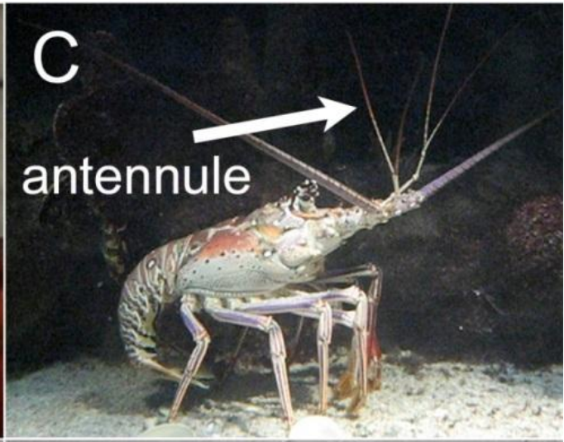
NEUR 411 · NEUROETHOLOGY · FALL 2026
Lecture 25
Chemoreception II: lobster olfactory search behavior
Friday, October 23, 2026
Jordan Lopez, Ph.D.
Professor of Neurobiology & Biomedical Engineering
Pravin & Reidenbach (2013), Fig. 1C. Caribbean spiny lobster with its lateral antennule labeled.
Notes:
Chemoreception II: lobster olfactory search behavior
Lecture 25. NEUR 411 · NEUROETHOLOGY · FALL 2026. Friday, October 23, 2026.
Figure: Pravin & Reidenbach (2013), Fig. 1C. Caribbean spiny lobster with its lateral antennule labeled.
Figure source: https://doi.org/10.3390/s131216591
• Lobsters sample transported food odors with antennules and other sensory surfaces. The original title photograph shows Panulirus argus, with its lateral antennule labeled; photograph J. A. Goldman, reproduced in Pravin and Reidenbach Figure 1C.
References:
Pravin S, Reidenbach MA (2013). Simultaneous Sampling of Flow and Odorants by Crustaceans can Aid Searches within a Turbulent Plume. Sensors 13(12):16591-16610. https://doi.org/10.3390/s131216591

Slide 2
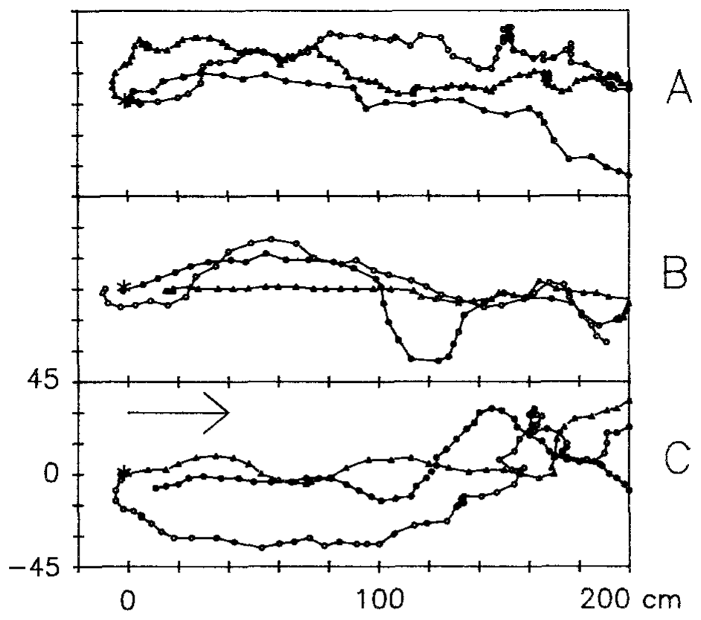
Food odor organizes source-directed walking
Chemoreception is the detection of chemicals by sensory cells. Clawed lobsters, Homarus americanus, use dissolved food odors to find sources while walking across the seabed. Moore, Scholz and Atema compared paths toward mussel extract with paths recorded during an equivalent delivery of raw seawater, so the chemical signal is the only difference between the two conditions.
The odor-search paths contained pauses, sideways movement and backward steps, yet they still progressed toward the source. Mean walking speed was 5.94 cm/s during odor trials, compared with 10.81 cm/s in controls. Slower movement therefore accompanies a more directed search, and speed alone tells little about how well an animal finds the source.
The trajectories show that chemical stimulation reorganizes locomotion under flowing-water conditions. Stop-and-go progress replaces steady walking, and the animal advances toward the odor source in bursts of movement interspersed with pauses. This pattern is the motor signature of an odor-guided search in a current, and the same stop-and-go structure appears in every odor trial that reaches the source.
Moore et al. (1991), Fig. 5A–C. Repeated recorded source-search paths of individual lobsters.
Moore et al. (1991)
02
Notes:
• Chemoreception is the detection of chemicals by sensory cells. Clawed lobsters, Homarus americanus, use dissolved food odors while walking across the seabed. Moore, Scholz and Atema compared paths toward mussel extract with paths recorded during otherwise equivalent raw-seawater delivery.
– A source-search path is the sequence of positions occupied by the animal. Its length, direction and speed are distinct variables; a slower path can be more useful if it remains associated with the odor plume.
• Odor-search paths contained pauses, sideways movement and backward steps while still progressing toward the source. Mean walking speed was 5.94 cm/s during odor trials, compared with 10.81 cm/s in controls. Faster movement therefore did not necessarily indicate better source-directed searching.
• The trajectories demonstrate that chemical stimulation reorganizes locomotion under flowing-water conditions. Chemical stimulation reorganizes walking into stop-and-go progress, in which a slower mean speed accompanies directed movement toward the source.
References:
Moore PA, Scholz N, Atema J (1991). Chemical orientation of lobsters, homarus americanus, in turbulent odor plumes. Journal of Chemical Ecology 17(7):1293-1307. https://doi.org/10.1007/bf00983763
Figure: Moore et al. (1991), Fig. 5A–C. Repeated recorded source-search paths of individual lobsters.
Figure source: https://doi.org/10.1007/bf00983763

Slide 3
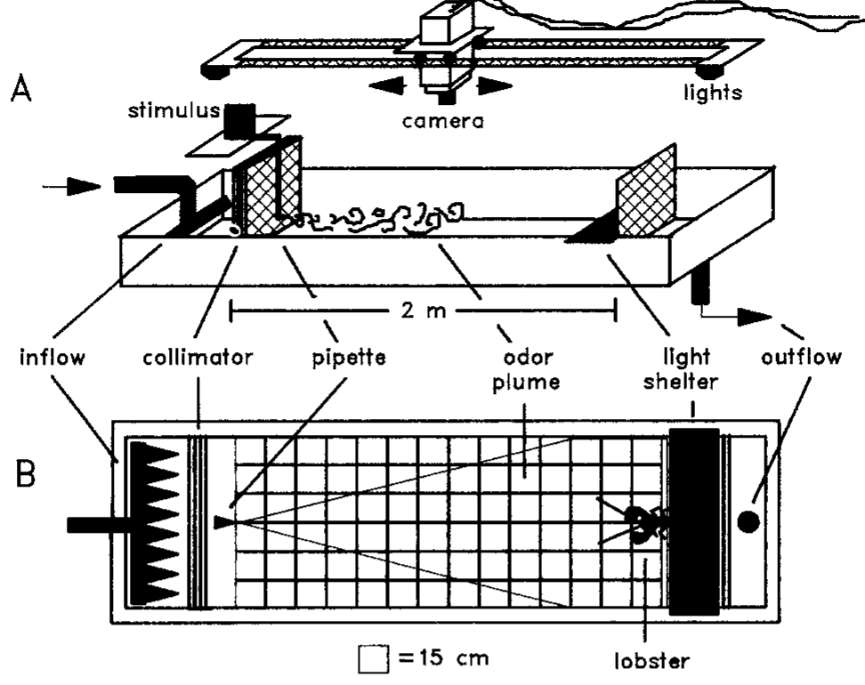
A flume separates chemical input from water flow
A flume is a channel that supplies controlled flowing water. Moore and colleagues tested lobsters in a 250 × 90 × 20 cm arena with a current of 1.0 cm/s. A reference grid and overhead video allowed position and heading to be measured.
Mussel extract at 0.5 g/L was delivered at 50 mL/min from a source 9 cm above the bottom. Control trials substituted raw seawater while retaining delivery conditions. Rostrum positions were digitized once per second, providing a common spatial and temporal reference for comparisons.
These controls attribute behavioral differences to the presence of the food extract rather than the existence of current or a delivery tube alone. Mussel extract is a mixture of food chemicals, and the odor reaching the animal downstream fluctuates in concentration as it travels from the source.
Moore et al. (1991), Fig. 1A–B. Flume, odor delivery and reference grid.
Moore et al. (1991)
03
Notes:
• A flume is a channel that supplies controlled flowing water. Moore and colleagues tested lobsters in a 250 × 90 × 20 cm arena with a current of 1.0 cm/s. A reference grid and overhead video allowed position and heading to be measured.
– The rostrum is the anterior projection used as a positional landmark. Turbulent dilution and the animal’s movement mean the chemical concentration at a receptor cannot be inferred directly from the source solution.
• Mussel extract at 0.5 g/L was delivered at 50 mL/min from a source 9 cm above the bottom. Control trials substituted raw seawater while retaining delivery conditions. Rostrum positions were digitized once per second, providing a common spatial and temporal reference for comparisons.
• These controls attribute behavioral differences to the presence of the food extract rather than the existence of current or a delivery tube alone. Mussel extract is a mixture of food chemicals, and the odor reaching the animal downstream fluctuates in concentration as it travels from the source.
References:
Moore PA, Scholz N, Atema J (1991). Chemical orientation of lobsters, homarus americanus, in turbulent odor plumes. Journal of Chemical Ecology 17(7):1293-1307. https://doi.org/10.1007/bf00983763
Figure: Moore et al. (1991), Fig. 1A–B. Flume, odor delivery and reference grid.
Figure source: https://doi.org/10.1007/bf00983763

Slide 4
A control trial holds everything but odor constant
A control trial is a run that keeps every condition of the test identical except the variable under study. Moore and colleagues used raw seawater in place of mussel extract, so the delivery tube, the pump and the water current were present in both kinds of trial.
The flume measured 250 × 90 × 20 cm with a current of 1.0 cm/s. Mussel extract at 0.5 g/L was delivered at 50 mL/min from a source 9 cm above the bottom, and seawater was delivered under the same conditions. Rostrum positions were digitized once per second.
Behavior that differs between extract and seawater trials can therefore be attributed to the chemical stimulus. Walking speed of 5.94 cm/s in odor trials against 10.81 cm/s in controls is a difference caused by the extract and not by flow or by the delivery apparatus.
Moore et al. (1991), Fig. 1A–B. Flume, odor delivery and reference grid.
Moore et al. (1991)
03a
Notes:
• Control trials make a behavioral difference interpretable.
• Definition.
– A control trial keeps every condition identical except the variable under study.
– Only the variable of interest changes between trial types.
• The control here.
– Raw seawater replaced mussel extract.
– The delivery tube, pump and current stayed in place.
• The flume.
– The arena measured 250 by 90 by 20 centimeters.
– The current was 1.0 centimeter per second.
• Delivery.
– Mussel extract at 0.5 grams per liter was delivered at 50 milliliters per minute.
– The source sat 9 centimeters above the bottom.
• Measurement.
– Rostrum positions were digitized once per second.
– A reference grid and overhead video gave position and heading.
• Result.
– Mean walking speed was 5.94 centimeters per second in odor trials.
– Controls averaged 10.81 centimeters per second.
• Meaning.
– The difference is attributed to the chemical stimulus because flow and delivery were matched.
• Why seawater.
– Seawater has no food chemicals but moves through the same tube at the same rate.
– Any difference in walking therefore comes from the extract.
• Interpretation.
– Speed was lower in odor trials because paths contained pauses, sideways steps and backward steps.
– Slower walking did not mean poorer progress toward the source.
References:
Moore PA, Scholz N, Atema J (1991). Chemical orientation of lobsters, homarus americanus, in turbulent odor plumes. Journal of Chemical Ecology 17(7):1293-1307. https://doi.org/10.1007/bf00983763

Slide 5
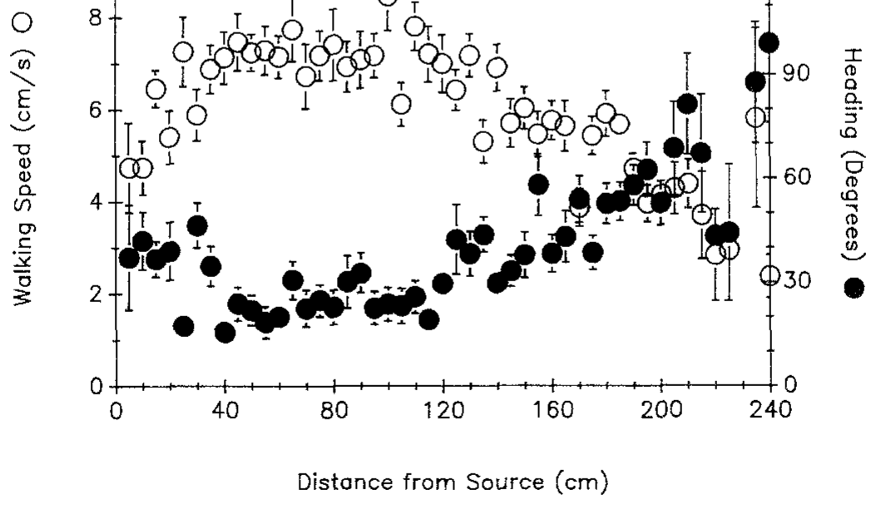
Speed and heading change during the approach
Heading angle describes the direction of the lobster’s body relative to upstream. Moore and colleagues grouped recorded behavior by distance from the source. This analysis asks whether the approach is uniform or changes as chemical and mechanical conditions change.
From 240 to 110 cm away, mean speed increased from 2.3 to 7.8 cm/s while heading decreased from 98.8° to about 20°. Between 110 and 40 cm, speed remained near 7 cm/s. Within the final 40 cm, speed fell toward 4.7 cm/s and heading increased toward 37°.
These transitions establish distinct movement regimes during successful searching. Successful searching passes through an acceleration phase, a fast and nearly straight middle phase, and a slower final phase with larger heading changes near the source.
Moore et al. (1991), Fig. 6. Walking speed and heading versus distance from the source.
Moore et al. (1991)
04
Notes:
• Heading angle describes the direction of the lobster’s body relative to upstream. Moore and colleagues grouped recorded behavior by distance from the source. This analysis asks whether the approach is uniform or changes as chemical and mechanical conditions change.
– A heading near zero is upstream; a larger angle can accompany lateral sampling. The last approach need not be the fastest because close-range localization can involve slowing and repositioning.
• From 240 to 110 cm away, mean speed increased from 2.3 to 7.8 cm/s while heading decreased from 98.8° to about 20°. Between 110 and 40 cm, speed remained near 7 cm/s. Within the final 40 cm, speed fell toward 4.7 cm/s and heading increased toward 37°.
• These transitions establish distinct movement regimes during successful searching. Successful searching passes through an acceleration phase, a fast and nearly straight middle phase, and a slower final phase with larger heading changes near the source.
References:
Moore PA, Scholz N, Atema J (1991). Chemical orientation of lobsters, homarus americanus, in turbulent odor plumes. Journal of Chemical Ecology 17(7):1293-1307. https://doi.org/10.1007/bf00983763
Figure: Moore et al. (1991), Fig. 6. Walking speed and heading versus distance from the source.
Figure source: https://doi.org/10.1007/bf00983763

Slide 6
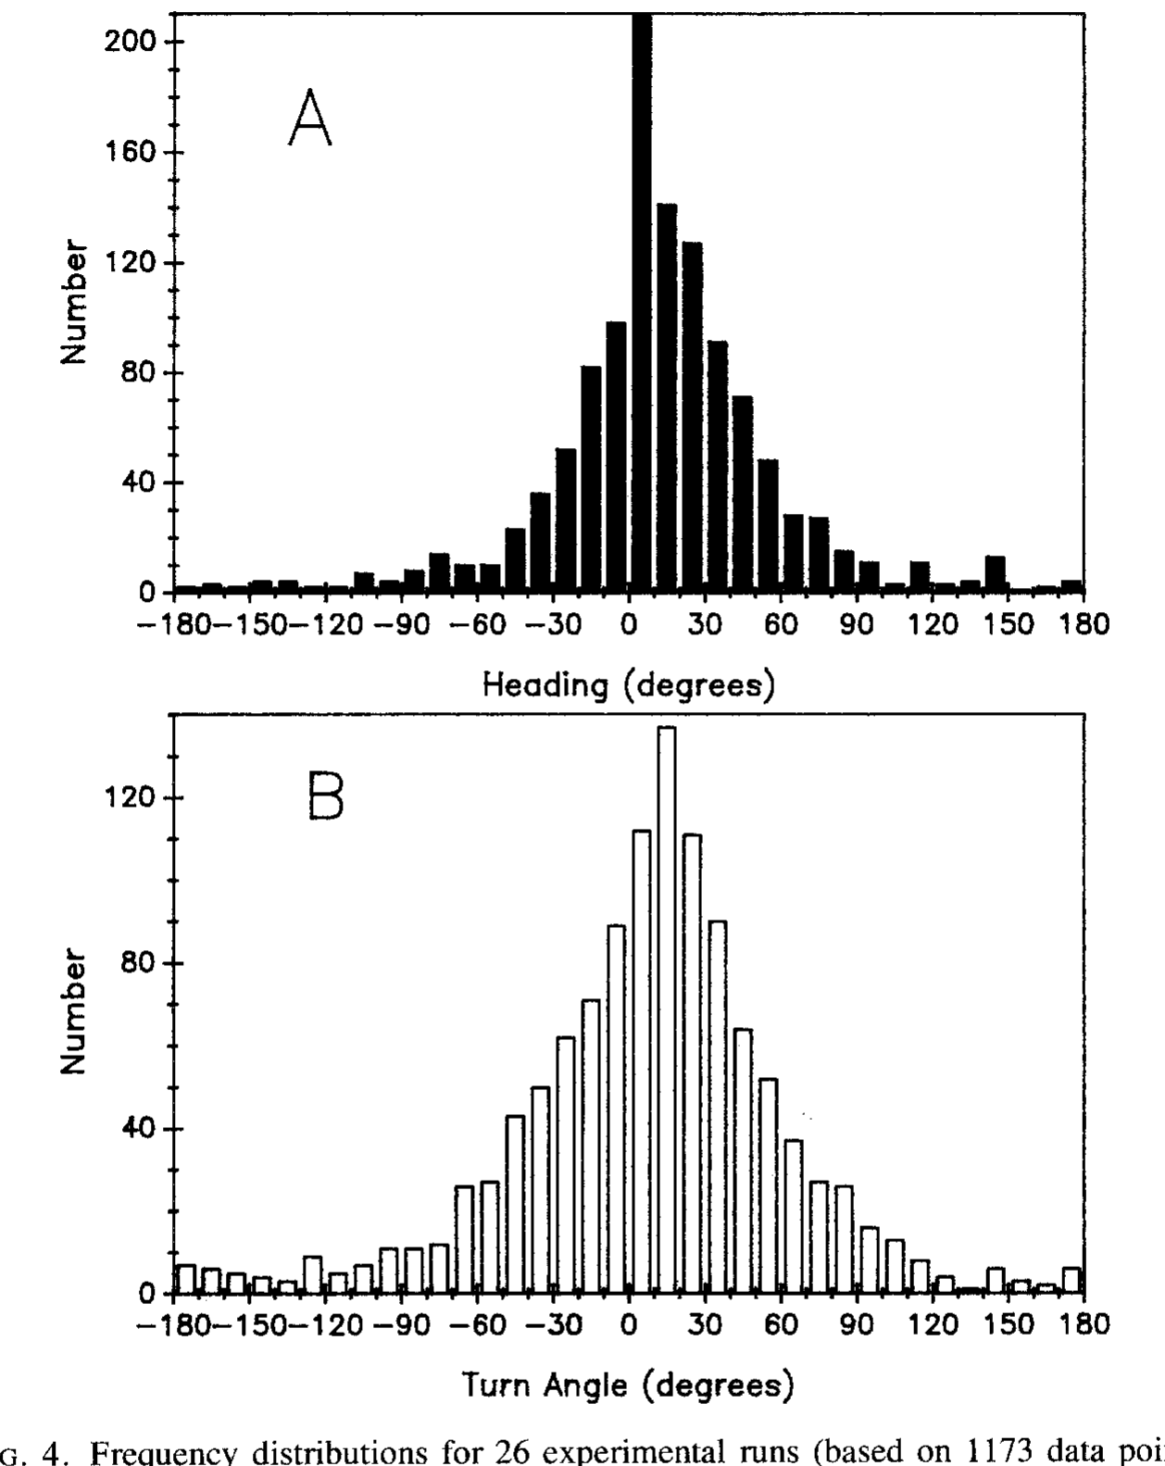
Recorded turns do not reveal a fixed casting program
Turning angle is the change in movement direction between successive path segments. Moore and colleagues compared heading and turn distributions in odor-search trials. A stereotyped alternating search program would predict consistently organized counterturns rather than the observed broad variation among paths.
Experimental headings were centered around 0–10°, and turns around 10–20°. Individual animals followed variable paths across repeated trials. Odor stimulation supported an upstream bias without producing a single characteristic path that every lobster repeated at fixed intervals.
The findings weaken a simple invariant counterturn account for this preparation. Odor biases heading upstream while each animal's path stays variable, which fits corrections adjusted as the animal meets odor and flow.
Moore et al. (1991), Fig. 4A–B. Heading and turning-angle distributions.
Moore et al. (1991)
05
Notes:
• Turning angle is the change in movement direction between successive path segments. Moore and colleagues compared heading and turn distributions in odor-search trials. A stereotyped alternating search program would predict consistently organized counterturns rather than the observed broad variation among paths.
– An absence of one stereotyped trajectory is different from an absence of neural organization. Feedback control can produce variable trajectories even when the same circuit is used on every trial.
• Experimental headings were centered around 0–10°, and turns around 10–20°. Individual animals followed variable paths across repeated trials. Odor stimulation supported an upstream bias without producing a single characteristic path that every lobster repeated at fixed intervals.
• The findings weaken a simple invariant counterturn account for this preparation. Odor biases heading upstream while each animal's path stays variable, which fits corrections adjusted as the animal meets odor and flow.
References:
Moore PA, Scholz N, Atema J (1991). Chemical orientation of lobsters, homarus americanus, in turbulent odor plumes. Journal of Chemical Ecology 17(7):1293-1307. https://doi.org/10.1007/bf00983763
Figure: Moore et al. (1991), Fig. 4A–B. Heading and turning-angle distributions.
Figure source: https://doi.org/10.1007/bf00983763

Slide 7
A motor program is a stored movement sequence
A motor program is a stored pattern of motor commands that generates a movement sequence, and sensory feedback can modify its timing or direction. A fixed alternating counterturn search would be one such program, with turns repeating at regular intervals.
Moore and colleagues recorded headings centered around 0–10° and turns around 10–20° in odor trials. Individual animals followed variable paths across repeated trials. Odor produced an upstream bias, and no single characteristic path was repeated by every lobster at fixed intervals.
A rigid program predicts consistently organized counterturns, and the broad variation among paths weakens that account for this preparation. Variable turns with an upstream bias fit corrections that are adjusted as the animal meets odor and flow along its route.
Moore et al. (1991), Fig. 4A–B. Heading and turning-angle distributions.
Moore et al. (1991)
05a
Notes:
• A motor program is one way to organize a search path.
• Definition.
– A motor program is a stored pattern of motor commands.
– Sensory feedback can modify its timing or direction.
• The hypothesis.
– A stereotyped alternating search would repeat counterturns at regular intervals.
– Every lobster would produce a similar path.
• Measured headings.
– Experimental headings centered around 0 to 10 degrees.
– Turns centered around 10 to 20 degrees.
• Variability.
– Individual animals followed variable paths across repeated trials.
– No single characteristic path appeared at fixed intervals.
• Upstream bias.
– Odor stimulation supported a bias toward upstream movement.
• Meaning.
– Broad variation among paths weakens a simple invariant counterturn account.
– Variable turns fit corrections adjusted by sensory input.
• Sensory feedback.
– Even a stored program can be adjusted by what the animal senses.
– Corrections made after each encounter would produce variable turns.
• Repeated trials.
– Each animal was tested more than once.
– Paths from the same animal still varied.
References:
Moore PA, Scholz N, Atema J (1991). Chemical orientation of lobsters, homarus americanus, in turbulent odor plumes. Journal of Chemical Ecology 17(7):1293-1307. https://doi.org/10.1007/bf00983763

Slide 8
Close-range searching recruits walking-leg raking
Moore and colleagues measured leg raking, repeated movements that bring walking-leg sensory surfaces into contact with the local environment. They compared raking rates at several distances from the odor source, testing whether close-range searching involves more than antennular sampling.
Raking averaged 3.4 events per 5 s within 7 cm of the source, 2.6 at 7–15 cm, and 1.15 at 15–22 cm. Beyond 22 cm it averaged only 0.1 per 5 s. Most recorded raking therefore occurred near the source.
The change supports recruitment of near-substrate sampling during final localization. Walking-leg contacts add sampling of the local environment to antennular sampling in the last centimeters before the source.
Moore et al. (1991), Fig. 5A–C. Repeated recorded source-search paths of individual lobsters.
Moore et al. (1991)
06
Notes:
• Moore and colleagues measured leg raking, repeated movements that bring walking-leg sensory surfaces into contact with the local environment. They compared raking rates at several distances from the odor source, testing whether close-range searching involves more than antennular sampling.
– The same recorded paths provide spatial context for the independent raking measurements. The figure does not plot raking frequency, and its trajectories should not be mistaken for a direct readout of leg-receptor activity.
• Raking averaged 3.4 events per 5 s within 7 cm of the source, 2.6 at 7–15 cm, and 1.15 at 15–22 cm. Beyond 22 cm it averaged only 0.1 per 5 s. Most recorded raking therefore occurred near the source.
• The change supports recruitment of near-substrate sampling during final localization. Walking-leg contacts add sampling of the local environment to antennular sampling in the last centimeters before the source.
References:
Moore PA, Scholz N, Atema J (1991). Chemical orientation of lobsters, homarus americanus, in turbulent odor plumes. Journal of Chemical Ecology 17(7):1293-1307. https://doi.org/10.1007/bf00983763
Figure: Moore et al. (1991), Fig. 5A–C. Repeated recorded source-search paths of individual lobsters.
Figure source: https://doi.org/10.1007/bf00983763

Slide 9
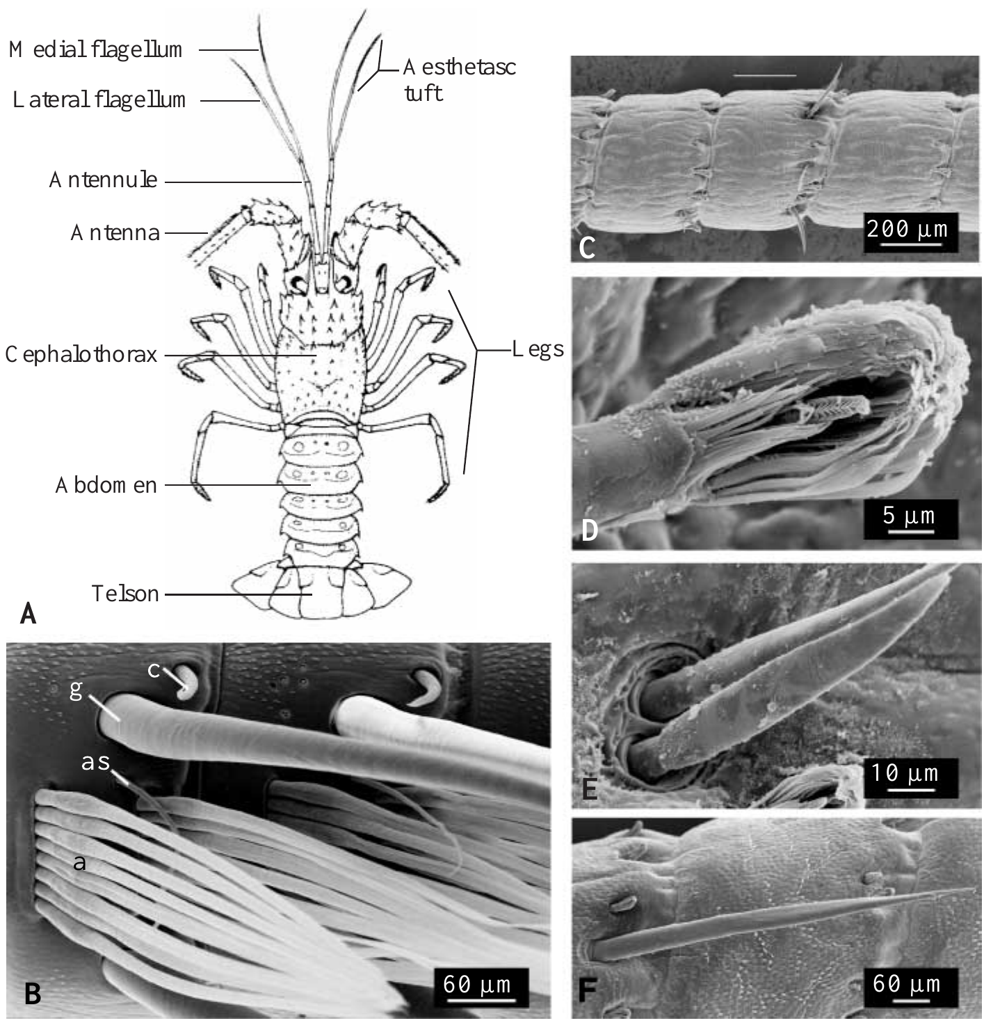
Two antennular pathways can guide spiny lobsters
The Caribbean spiny lobster, Panulirus argus, differs from the clawed lobster used in the earlier flume study. Its antennules carry aesthetascs, specialized olfactory hairs, together with non-aesthetasc sensilla containing other chemical and mechanical sensory neurons. These populations offer potentially overlapping information.
Horner, Weissburg and Derby tested 48–74 mm carapace-length animals in a 5,000-L flume with flow near 5 cm/s. Shrimp extract at 3 or 0.3 g/L supplied high- and low-odor treatments; seawater supplied a chemical control. Selective manipulations targeted different sensory populations on both antennules.
The experiment asks whether one pathway is indispensable for food-source localization under realistic flow. A preserved response after removing one population can show that the remaining pathway is sufficient in this assay. Aesthetascs and non-aesthetasc sensilla therefore define two candidate pathways whose contributions can be tested by removing each population on both antennules.
Horner et al. (2004), Fig. 1A–F. Body and antennular sensory structures.
Horner et al. (2004)
07
Notes:
• The Caribbean spiny lobster, Panulirus argus, differs from the clawed lobster used in the earlier flume study. Its antennules carry aesthetascs, specialized olfactory hairs, together with non-aesthetasc sensilla containing other chemical and mechanical sensory neurons. These populations offer potentially overlapping information.
– A sensillum is a cuticular sensory structure. Aesthetasc and non-aesthetasc pathways are anatomical categories, not merely strong and weak versions of one measured receptor response.
• Horner, Weissburg and Derby tested 48–74 mm carapace-length animals in a 5,000-L flume with flow near 5 cm/s. Shrimp extract at 3 or 0.3 g/L supplied high- and low-odor treatments; seawater supplied a chemical control. Selective manipulations targeted different sensory populations on both antennules.
• The experiment asks whether one pathway is indispensable for food-source localization under realistic flow. A preserved response after removing one population can show that the remaining pathway is sufficient in this assay. Aesthetascs and non-aesthetasc sensilla therefore define two candidate pathways whose contributions can be tested by removing each population on both antennules.
References:
Horner AJ, Weissburg MJ, Derby CD (2004). Dual antennular chemosensory pathways can mediate orientation by Caribbean spiny lobsters in naturalistic flow conditions. Journal of Experimental Biology 207(21):3785-3796. https://doi.org/10.1242/jeb.01200
Figure: Horner et al. (2004), Fig. 1A–F. Body and antennular sensory structures.
Figure source: https://doi.org/10.1242/jeb.01200

Slide 10
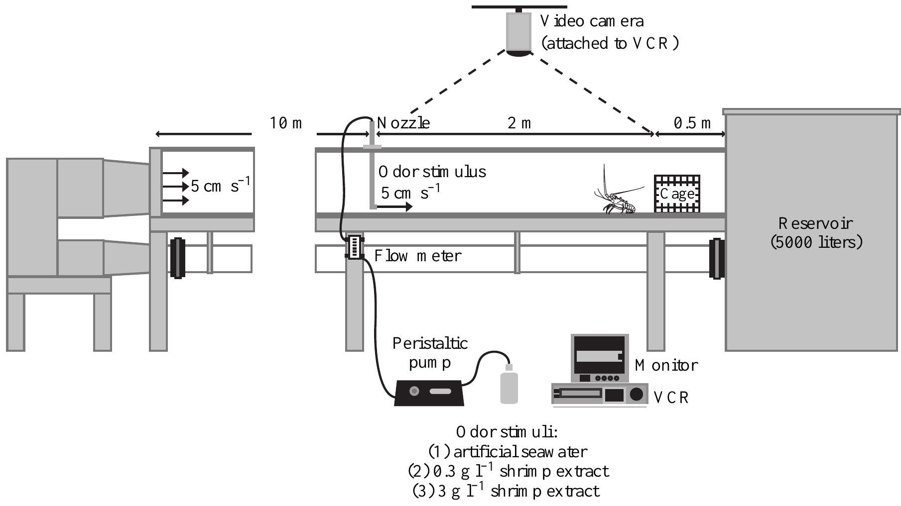
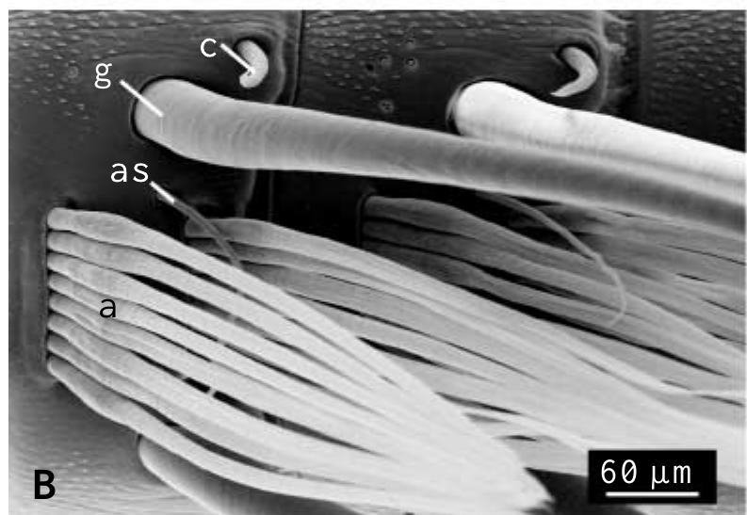
Selective lesions require distinct procedural controls
Horner and colleagues used several interventions because sensory hairs can contain different neuron types. Shaving removed about 99.8% of aesthetascs. Removing and sealing non-aesthetasc sensilla targeted another pathway, while a 15-min distilled-water treatment temporarily impaired antennular chemosensitivity.
The source was positioned 2 m upstream of release. High and low shrimp concentrations were compared with seawater, and animals were offered shrimp afterward to check feeding motivation. Some manipulations also affected mechanoreceptors, an important qualification when interpreting a failure to orient.
The combination separates chemical guidance from complete loss of appetite more effectively than a lesion alone. Distilled-water treatment is reversible over approximately 24 h, but is not a molecularly selective receptor knockout. Orientation failure after a treatment then reflects loss of the sensory population that treatment affected.
Horner et al. (2004), Fig. 2. Shrimp-odor source, flow chamber and lobster release position.
Horner et al. (2004), Fig. 1B. Scanning electron micrograph of aesthetasc and guard hairs.
Horner et al. (2004)
08
Notes:
• Horner and colleagues used several interventions because sensory hairs can contain different neuron types. Shaving removed about 99.8% of aesthetascs. Removing and sealing non-aesthetasc sensilla targeted another pathway, while a 15-min distilled-water treatment temporarily impaired antennular chemosensitivity.
– A behavioral lesion experiment requires both confirmation of sensory removal and a control for non-sensory impairment. Feeding after the trial helps assess motivation but does not prove that every aspect of locomotor function was unchanged.
• The source was positioned 2 m upstream of release. High and low shrimp concentrations were compared with seawater, and animals were offered shrimp afterward to check feeding motivation. Some manipulations also affected mechanoreceptors, an important qualification when interpreting a failure to orient.
• The combination separates chemical guidance from complete loss of appetite more effectively than a lesion alone. Distilled-water treatment is reversible over approximately 24 h, but is not a molecularly selective receptor knockout. Orientation failure after a treatment then reflects loss of the sensory population that treatment affected.
References:
Horner AJ, Weissburg MJ, Derby CD (2004). Dual antennular chemosensory pathways can mediate orientation by Caribbean spiny lobsters in naturalistic flow conditions. Journal of Experimental Biology 207(21):3785-3796. https://doi.org/10.1242/jeb.01200
Figure: Horner et al. (2004), Fig. 2. Shrimp-odor source, flow chamber and lobster release position.
Figure source: https://doi.org/10.1242/jeb.01200
Figure: Horner et al. (2004), Fig. 1B. Scanning electron micrograph of aesthetasc and guard hairs.
Figure source: https://doi.org/10.1242/jeb.01200

Slide 11
Sensory ablation removes one input at a time
Sensory ablation is the removal or inactivation of a defined sensory structure to test what that structure contributes to a behavior. Horner and colleagues applied it to two populations of sensilla on both antennules of the spiny lobster, the aesthetascs and the non-aesthetasc chemo-mechanosensory hairs.
Shaving removed about 99.8% of aesthetascs. Removing and sealing the non-aesthetasc sensilla targeted the second pathway, and a 15-min distilled-water treatment temporarily impaired antennular chemosensitivity for approximately 24 h. Animals were offered shrimp afterward to check feeding motivation.
Comparing intact animals with each ablated group asks which population is needed for finding a source upstream. The feeding test separates a loss of sensory information from a loss of appetite, so a failure to orient can be assigned to the sensory population that was removed.
Horner et al. (2004), Fig. 2. Shrimp-odor source, flow chamber and lobster release position.
Horner et al. (2004), Fig. 1B. Scanning electron micrograph of aesthetasc and guard hairs.
Horner et al. (2004)
08a
Notes:
• Selective ablation tests the contribution of one pathway.
• Definition.
– Sensory ablation removes or inactivates a defined sensory structure.
– The behavior is then compared with intact animals.
• Two pathways.
– Aesthetascs are specialized olfactory hairs.
– Non-aesthetasc sensilla carry chemical and mechanical sensory neurons.
• Shaving.
– Shaving removed about 99.8 percent of aesthetascs.
• Sealing.
– Removing and sealing the non-aesthetasc sensilla targeted the other pathway.
• Distilled water.
– A 15-minute treatment temporarily impaired antennular chemosensitivity.
– The effect reversed over approximately 24 hours.
• Motivation check.
– Animals were offered shrimp afterward.
– This separates lost sensing from lost appetite.
• Source position.
– The source was positioned 2 meters upstream of release.
• Why several treatments.
– Sensory hairs can contain different neuron types.
– Each treatment targets a different population or function.
• Mechanoreceptors.
– Some manipulations also affected mechanoreceptors.
– A failure to orient is interpreted with that overlap in mind.
• Comparison groups.
– Intact animals provide the baseline for source finding.
– Each ablated group is compared with that baseline in the same flume under the same flow.
– High and low shrimp concentrations were compared with seawater.
References:
Horner AJ, Weissburg MJ, Derby CD (2004). Dual antennular chemosensory pathways can mediate orientation by Caribbean spiny lobsters in naturalistic flow conditions. Journal of Experimental Biology 207(21):3785-3796. https://doi.org/10.1242/jeb.01200

Slide 12
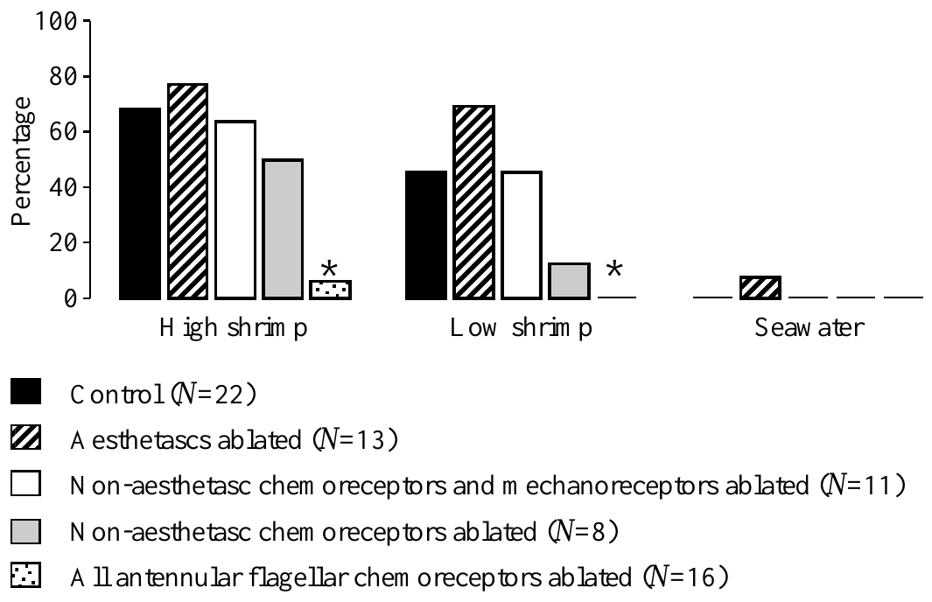
Either pathway can preserve food-source finding
Horner and colleagues measured the proportion of lobsters reaching the odor source after selective bilateral sensory manipulation. Intact animals found the high-odor source in 68% of trials and the low-odor source in 45%; no intact animal located a seawater source.
After aesthetasc removal, success remained 77% for high odor and 69% for low odor. Removing non-aesthetasc chemo-mechanosensory sensilla also preserved source finding, at 64% and 45%. In contrast, eliminating antennular chemoreceptor input broadly produced very poor localization.
Either retained antennular chemical pathway can therefore support this food-search task. Input from the aesthetascs or from the non-aesthetasc sensilla is enough to localize the source, whereas broad loss of antennular chemoreceptor input leaves localization very poor.
Horner et al. (2004), Fig. 3. Source-finding success after selective antennular lesions.
Horner et al. (2004), Fig. 1B. Scanning electron micrograph of aesthetasc and guard hairs.
Horner et al. (2004)
09
Notes:
• Horner and colleagues measured the proportion of lobsters reaching the odor source after selective bilateral sensory manipulation. Intact animals found the high-odor source in 68% of trials and the low-odor source in 45%; no intact animal located a seawater source.
– Necessity and sufficiency are different claims. Preserved behavior after one pathway is removed argues against its unique necessity here; it does not remove the possibility that it normally contributes useful information.
• After aesthetasc removal, success remained 77% for high odor and 69% for low odor. Removing non-aesthetasc chemo-mechanosensory sensilla also preserved source finding, at 64% and 45%. In contrast, eliminating antennular chemoreceptor input broadly produced very poor localization.
• Either retained antennular chemical pathway can therefore support this food-search task. Input from the aesthetascs or from the non-aesthetasc sensilla is enough to localize the source, whereas broad loss of antennular chemoreceptor input leaves localization very poor.
References:
Horner AJ, Weissburg MJ, Derby CD (2004). Dual antennular chemosensory pathways can mediate orientation by Caribbean spiny lobsters in naturalistic flow conditions. Journal of Experimental Biology 207(21):3785-3796. https://doi.org/10.1242/jeb.01200
Figure: Horner et al. (2004), Fig. 3. Source-finding success after selective antennular lesions.
Figure source: https://doi.org/10.1242/jeb.01200
Figure: Horner et al. (2004), Fig. 1B. Scanning electron micrograph of aesthetasc and guard hairs.
Figure source: https://doi.org/10.1242/jeb.01200

Slide 13
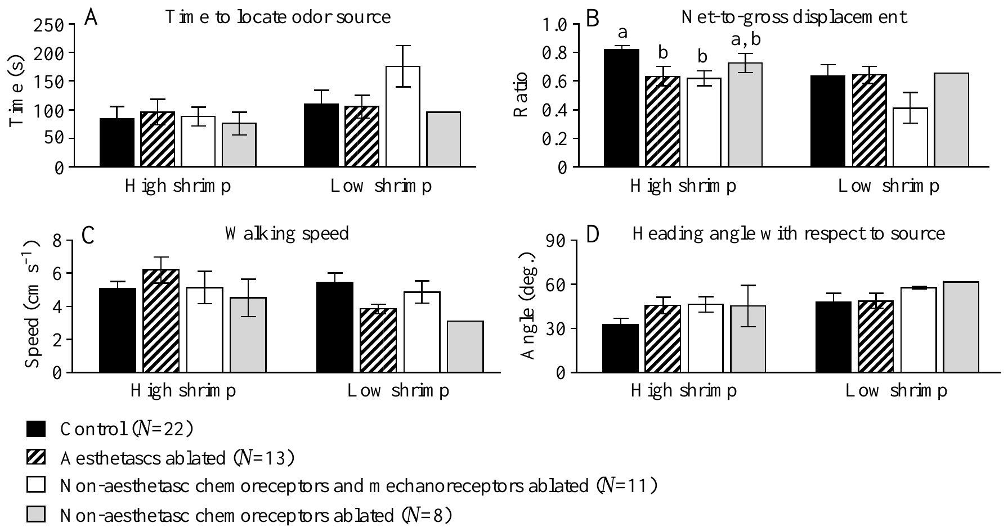
Successful searching can still become less efficient
Net-to-gross displacement ratio, or NGDR, is straight-line displacement divided by total path length. A value closer to one indicates a straighter route. Horner and colleagues measured this variable separately from eventual source-finding success, together with arrival time, speed and heading.
At high odor concentration, mean NGDR was 0.82 in controls, compared with 0.63 after aesthetasc removal and 0.62 after non-aesthetasc chemo-mechanosensory removal. Mean arrival times across treatment groups were at most 96 s for high odor and 176 s for low odor.
Remaining sensory pathways can preserve arrival while losing efficient progress. An NGDR falling from 0.82 to about 0.62 means that treated animals walked longer, more winding paths to cover the same straight-line distance, so each pathway contributes to route efficiency as well as to arrival.
Horner et al. (2004), Fig. 4A–D. Arrival time, path straightness, walking speed and heading.
Horner et al. (2004), Fig. 1B. Scanning electron micrograph of aesthetasc and guard hairs.
Horner et al. (2004)
10
Notes:
• Net-to-gross displacement ratio, or NGDR, is straight-line displacement divided by total path length. A value closer to one indicates a straighter route. Horner and colleagues measured this variable separately from eventual source-finding success, together with arrival time, speed and heading.
– Arrival and path straightness measure different properties. A lobster that eventually succeeds can still expend more walking distance, encounter more interruptions or require more opportunities to correct its direction.
• At high odor concentration, mean NGDR was 0.82 in controls, compared with 0.63 after aesthetasc removal and 0.62 after non-aesthetasc chemo-mechanosensory removal. Mean arrival times across treatment groups were at most 96 s for high odor and 176 s for low odor.
• Remaining sensory pathways can preserve arrival while losing efficient progress. An NGDR falling from 0.82 to about 0.62 means that treated animals walked longer, more winding paths to cover the same straight-line distance, so each pathway contributes to route efficiency as well as to arrival.
References:
Horner AJ, Weissburg MJ, Derby CD (2004). Dual antennular chemosensory pathways can mediate orientation by Caribbean spiny lobsters in naturalistic flow conditions. Journal of Experimental Biology 207(21):3785-3796. https://doi.org/10.1242/jeb.01200
Figure: Horner et al. (2004), Fig. 4A–D. Arrival time, path straightness, walking speed and heading.
Figure source: https://doi.org/10.1242/jeb.01200
Figure: Horner et al. (2004), Fig. 1B. Scanning electron micrograph of aesthetasc and guard hairs.
Figure source: https://doi.org/10.1242/jeb.01200

Slide 14
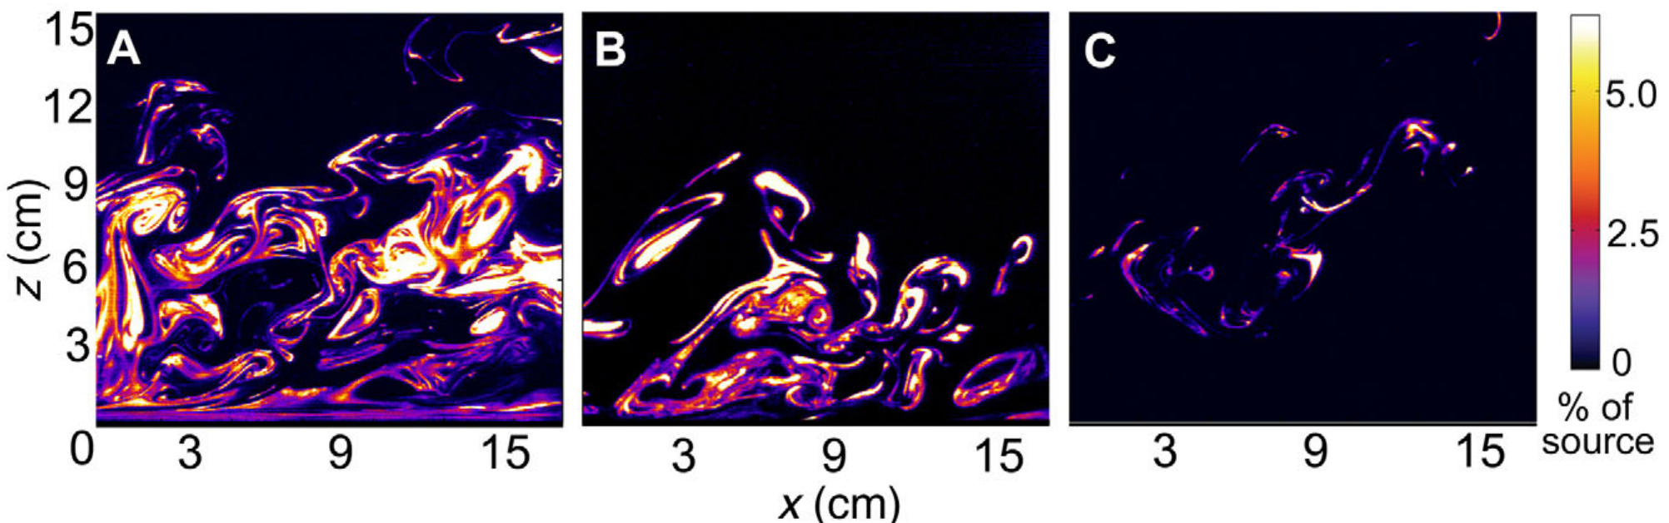
Turbulence produces patchy dissolved odor input
An odor plume is the distribution of odor-bearing water transported downstream from a source. Reidenbach and Koehl visualized plumes using planar laser-induced fluorescence, or PLIF: a thin laser sheet excites dissolved dye, and calibrated camera intensity estimates local concentration.
Their 25-m flume produced fine odor filaments separated by cleaner water. Images were recorded at 60 frames/s, yielding 16.7-ms temporal resolution. Measurements at different lateral positions showed a denser central plume and sparser encounters toward its edge.
The images record the physical odor input available to a sensory appendage. A smooth time-averaged concentration field conceals the intermittent encounters and gaps that a moving animal actually samples.
Reidenbach & Koehl (2011), Fig. 3A–C. Measured dye plumes under three flow conditions.
Reidenbach & Koehl (2011)
11
Notes:
• An odor plume is the distribution of odor-bearing water transported downstream from a source. Reidenbach and Koehl visualized plumes using planar laser-induced fluorescence, or PLIF: a thin laser sheet excites dissolved dye, and calibrated camera intensity estimates local concentration.
– PLIF provides chemical-transport information in a plane. It does not measure every location in a three-dimensional plume at once, and the concentration represented by color is calibrated dye concentration.
• Their 25-m flume produced fine odor filaments separated by cleaner water. Images were recorded at 60 frames/s, yielding 16.7-ms temporal resolution. Measurements at different lateral positions showed a denser central plume and sparser encounters toward its edge.
• The images record the physical odor input available to a sensory appendage. A smooth time-averaged concentration field conceals the intermittent encounters and gaps that a moving animal actually samples.
References:
Reidenbach MA, Koehl MAR (2011). The spatial and temporal patterns of odors sampled by lobsters and crabs in a turbulent plume. Journal of Experimental Biology 214(18):3138–3153. https://doi.org/10.1242/jeb.057547
Figure: Reidenbach & Koehl (2011), Fig. 3A–C. Measured dye plumes under three flow conditions.
Figure source: https://doi.org/10.1242/jeb.057547

Slide 15
PLIF turns dissolved dye into a concentration map
Planar laser-induced fluorescence, or PLIF, measures dissolved odor in flowing water. A thin laser sheet excites fluorescent dye in the plume, and the brightness recorded by a calibrated camera estimates the local concentration at each point in the imaged plane.
Reidenbach and Koehl imaged plumes in a 25-m flume at 60 frames/s, which gives a temporal resolution of 16.7 ms. The images resolved fine odor filaments separated by cleaner water, with a denser central plume and sparser encounters toward its edge.
Each pixel in an image is a concentration measurement, so a series of frames reproduces the sequence of encounters and gaps that a sensory surface would meet. The method records the physical odor input available to an animal, before any receptor responds.
Reidenbach & Koehl (2011), Fig. 3A–C. Measured dye plumes under three flow conditions.
Reidenbach & Koehl (2011)
11a
Notes:
• PLIF makes the structure of a plume visible.
• Method.
– A thin laser sheet excites fluorescent dye dissolved in the water.
– The dye glows only in the illuminated plane.
• Calibration.
– A calibrated camera converts brightness into an estimate of local concentration.
• Flume.
– The flume was 25 meters long.
– Turbulence produced fine odor filaments separated by cleaner water.
• Time resolution.
– Images were recorded at 60 frames per second.
– Each frame is separated by 16.7 milliseconds.
• Spatial pattern.
– Measurements at different lateral positions showed a denser central plume.
– Encounters were sparser toward the edge.
• Meaning.
– A series of frames reproduces the encounters and gaps that a sensory surface would meet.
• Why dye.
– Dye follows the water, so its brightness maps where odor-bearing water travels.
– Dissolved dye acts as a transport tracer.
• Lateral positions.
– Measurements were made at several lateral positions across the plume.
– The center was denser than the edge.
• Resolution.
– Sixty frames per second resolves filaments that pass in tens of milliseconds.
– A slower camera would blur separate filaments into one smooth patch.
– Fine temporal detail is needed to describe what a flicking antennule meets.
References:
Reidenbach MA, Koehl MAR (2011). The spatial and temporal patterns of odors sampled by lobsters and crabs in a turbulent plume. Journal of Experimental Biology 214(18):3138–3153. https://doi.org/10.1242/jeb.057547

Slide 16
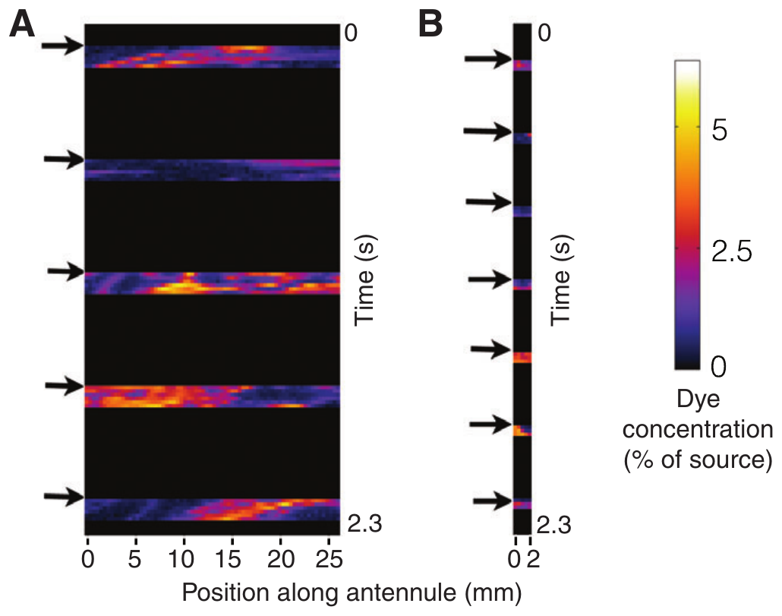
Antennular length changes the sampled chemical pattern
Reidenbach and Koehl placed virtual sampling lines within measured PLIF images to represent the aesthetasc-bearing portion of an antennule. Lobster and blue-crab geometries were compared at the same 8-cm height. This approach separates appendage geometry from differences in chemical receptor sensitivity.
The lobster sampler flicked at 2 Hz and moved at 6 cm/s during the downstroke. The crab sampler was only 2 mm long and flicked at 3 Hz. Lobster geometry intercepted odor during more flicks and sampled higher peak concentrations than crab geometry.
Longer sampling structures can encounter more filaments, while faster sampling can partly compensate for shorter length. Sampling geometry and flick rate determine how much of the filament structure of the plume reaches the receptors, independent of receptor sensitivity.
Reidenbach & Koehl (2011), Fig. 5A–B. Colored plume filaments and concentration along a sampling transect.
Reidenbach & Koehl (2011)
12
Notes:
• Reidenbach and Koehl placed virtual sampling lines within measured PLIF images to represent the aesthetasc-bearing portion of an antennule. Lobster and blue-crab geometries were compared at the same 8-cm height. This approach separates appendage geometry from differences in chemical receptor sensitivity.
– A virtual sampler is an analysis of physical measurements, not a recording of a receptor neuron. Its value is to isolate which aspects of the input depend on appendage size and motion.
• The lobster sampler flicked at 2 Hz and moved at 6 cm/s during the downstroke. The crab sampler was only 2 mm long and flicked at 3 Hz. Lobster geometry intercepted odor during more flicks and sampled higher peak concentrations than crab geometry.
• Longer sampling structures can encounter more filaments, while faster sampling can partly compensate for shorter length. Sampling geometry and flick rate determine how much of the filament structure of the plume reaches the receptors, independent of receptor sensitivity.
References:
Reidenbach MA, Koehl MAR (2011). The spatial and temporal patterns of odors sampled by lobsters and crabs in a turbulent plume. Journal of Experimental Biology 214(18):3138–3153. https://doi.org/10.1242/jeb.057547
Figure: Reidenbach & Koehl (2011), Fig. 5A–B. Colored plume filaments and concentration along a sampling transect.
Figure source: https://doi.org/10.1242/jeb.057547

Slide 17
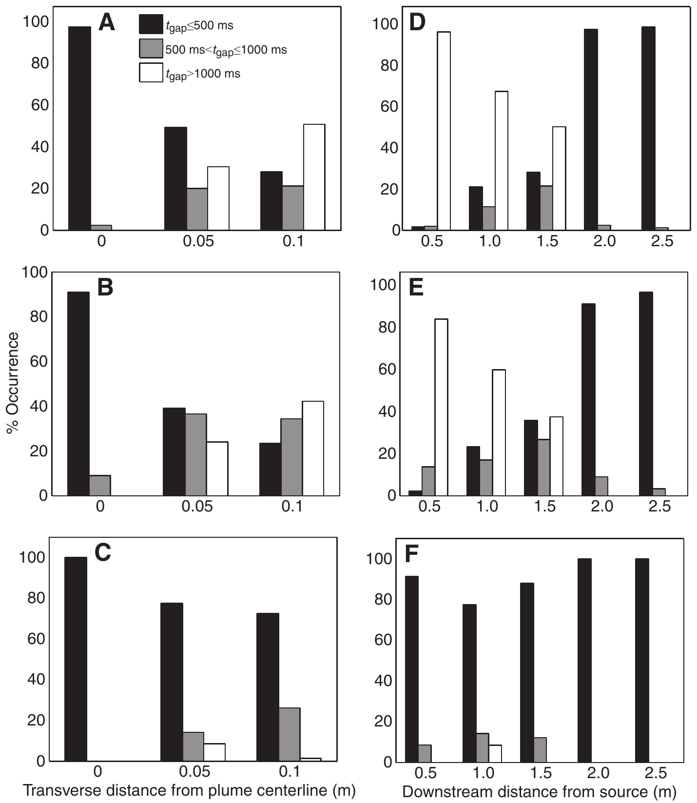
Discrete sniffing changes the gaps between encounters
An odor-free gap is an interval without an encounter above the chosen detection threshold. Reidenbach and Koehl compared continuous concentration measurements with the concentrations encountered by virtual flicking antennules. The comparison shows how intermittent sampling changes the timing of the chemical information available to the animal, because a sampler that moves in discrete steps meets a different sequence of concentrations than a continuous sensor does.
Almost all gaps in the continuously measured concentration were shorter than 500 ms throughout the sampled plume. Flicking antennules instead experienced longer gaps, and these gaps grew as the distance to the source decreased. The sampling schedule therefore altered the statistics of the input before any neural processing occurred, so the same plume delivered a different temporal pattern to the animal.
The distance relationship is counterintuitive, because encounter frequency changes with plume transport, threshold and flicking geometry rather than with distance alone. Gap timing is a temporal cue produced jointly by the plume and the sampling schedule, and an animal that samples intermittently can read that cue to judge its position within the plume.
Reidenbach & Koehl (2011), Fig. 7A–F. Odor-free gap categories for flicking and continuous sampling.
Reidenbach & Koehl (2011)
13
Notes:
• An odor-free gap is an interval without an encounter above the chosen detection threshold. Reidenbach and Koehl compared continuous concentration measurements with concentrations encountered by virtual flicking antennules. The comparison tests whether intermittent movement changes the timing of available chemical information.
– A sensor can miss a passing filament between samples. Therefore, an odor-free interval in the sampled record need not mean there was no odor-bearing water anywhere near the animal.
• Almost all gaps in continuously measured concentration were shorter than 500 ms throughout the sampled plume. Flicking antennules instead experienced longer gaps, and their gaps increased as downstream distance to the source decreased. Sampling schedule altered the input statistics before neural processing occurred.
• The counterintuitive distance relationship shows why encounter frequency cannot be treated as a universal distance ruler. The result depends on plume transport, threshold and flicking geometry. Gap timing is a temporal cue produced jointly by the plume and the sampling schedule.
References:
Reidenbach MA, Koehl MAR (2011). The spatial and temporal patterns of odors sampled by lobsters and crabs in a turbulent plume. Journal of Experimental Biology 214(18):3138–3153. https://doi.org/10.1242/jeb.057547
Figure: Reidenbach & Koehl (2011), Fig. 7A–F. Odor-free gap categories for flicking and continuous sampling.
Figure source: https://doi.org/10.1242/jeb.057547

Slide 18
Intermittency is the on-off structure of odor
Intermittency is the on-off structure of odor in a turbulent plume: concentration rises above a detection threshold in brief filaments and falls to near zero in the gaps between them. A sensor therefore meets bursts of odor separated by odor-free intervals.
Reidenbach and Koehl compared continuous concentration measurements with samples taken by virtual flicking antennules. Almost all gaps in the continuous record were shorter than 500 ms. Flicking antennules experienced longer gaps, and those gaps increased as the distance to the source decreased.
The sampling schedule therefore changes the statistics of the input before neural processing occurs. Gap length depends on plume transport, the chosen threshold and flicking geometry, so encounter frequency does not serve as a universal distance ruler.
Reidenbach & Koehl (2011), Fig. 7A–F. Odor-free gap categories for flicking and continuous sampling.
Reidenbach & Koehl (2011)
13a
Notes:
• Intermittency describes odor as a sequence of encounters and gaps.
• Definition.
– Intermittency is the temporal discontinuity of odor.
– Concentration crosses a detection threshold in brief filaments.
• Odor-free gap.
– A gap is an interval without an encounter above the threshold.
• Continuous measurement.
– Almost all gaps in the continuous record were shorter than 500 milliseconds.
• Flicking antennules.
– Virtual flicking antennules experienced longer gaps.
– Gaps increased as distance to the source decreased.
• Dependence.
– The result depends on plume transport, threshold and flicking geometry.
• Meaning.
– Sampling schedule alters the input statistics before neural processing.
– Encounter frequency is not a universal distance ruler.
• Threshold.
– An encounter is counted when concentration exceeds the chosen threshold.
– A different threshold changes which gaps are counted.
• Virtual sampling.
– The flicking antennules were virtual sampling lines placed in measured images.
– They were compared with continuous measurements at the same positions.
• Timing cue.
– Gap length depends on where the animal samples, on its sampling schedule and on the plume.
– It is a cue that arises from physical transport and sampling together.
– Sampling schedule altered the input before any neuron responded.
References:
Reidenbach MA, Koehl MAR (2011). The spatial and temporal patterns of odors sampled by lobsters and crabs in a turbulent plume. Journal of Experimental Biology 214(18):3138–3153. https://doi.org/10.1242/jeb.057547

Slide 19
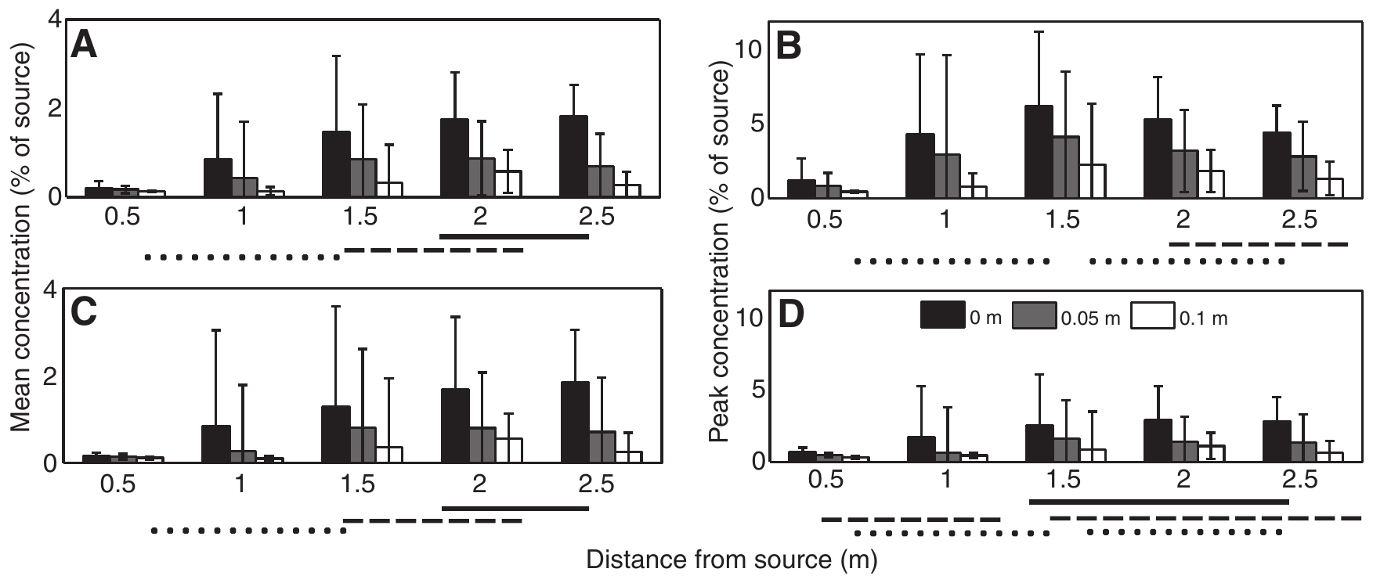
Antennules and legs encounter different gradients
Near the seabed, transport and mixing differ from conditions several centimeters above it. Reidenbach and Koehl compared chemical samples at antennular height with samples taken near walking-leg height. The same source therefore generates different concentration patterns for different sensory surfaces, so the position of a sensor determines which chemical gradient it reads.
Mean sampled concentrations near the bed increased toward the source, whereas the mean concentrations sampled higher by flicking antennules decreased toward it in this preparation. Variance was also lower near the bed. The measurements covered downstream positions from about 1 to 2.5 m, which places the contrast within the range where walking animals search.
Close-range leg sampling and distant antennular sampling provide different information. The rise in mean concentration near the bed close to the source matches the increase in leg raking during Homarus approaches, because the walking legs sample where bed concentration is rising. Each sensory surface therefore contributes its own gradient to a single search.
Reidenbach & Koehl (2011), Fig. 8A–D. Encountered concentrations versus source distance.
Reidenbach & Koehl (2011); Moore et al. (1991)
14
Notes:
• Near the seabed, transport and mixing differ from conditions several centimeters above it. Reidenbach and Koehl compared chemical samples at antennular height with samples near walking-leg height. The same source can therefore generate different concentration patterns for different sensory surfaces.
– A boundary layer is the region near a surface where flow is influenced by that surface. Sensory location within it changes chemical exposure even when the animal’s distance to the food source is unchanged.
• Mean sampled concentrations near the bed increased toward the source, whereas mean concentrations sampled higher by flicking antennules decreased toward it in this preparation. Variance was also lower near the bed. Measurements covered downstream positions from approximately 1 to 2.5 m.
• Close-range leg sampling and distant antennular sampling need not provide interchangeable information. Higher mean concentration near the bed close to the source fits the rise in leg raking during Homarus approaches, because walking legs sample where bed concentration is increasing.
References:
Reidenbach MA, Koehl MAR (2011). The spatial and temporal patterns of odors sampled by lobsters and crabs in a turbulent plume. Journal of Experimental Biology 214(18):3138–3153. https://doi.org/10.1242/jeb.057547
Moore PA, Scholz N, Atema J (1991). Chemical orientation of lobsters, homarus americanus, in turbulent odor plumes. Journal of Chemical Ecology 17(7):1293-1307. https://doi.org/10.1007/bf00983763
Figure: Reidenbach & Koehl (2011), Fig. 8A–D. Encountered concentrations versus source distance.
Figure source: https://doi.org/10.1242/jeb.057547

Slide 20
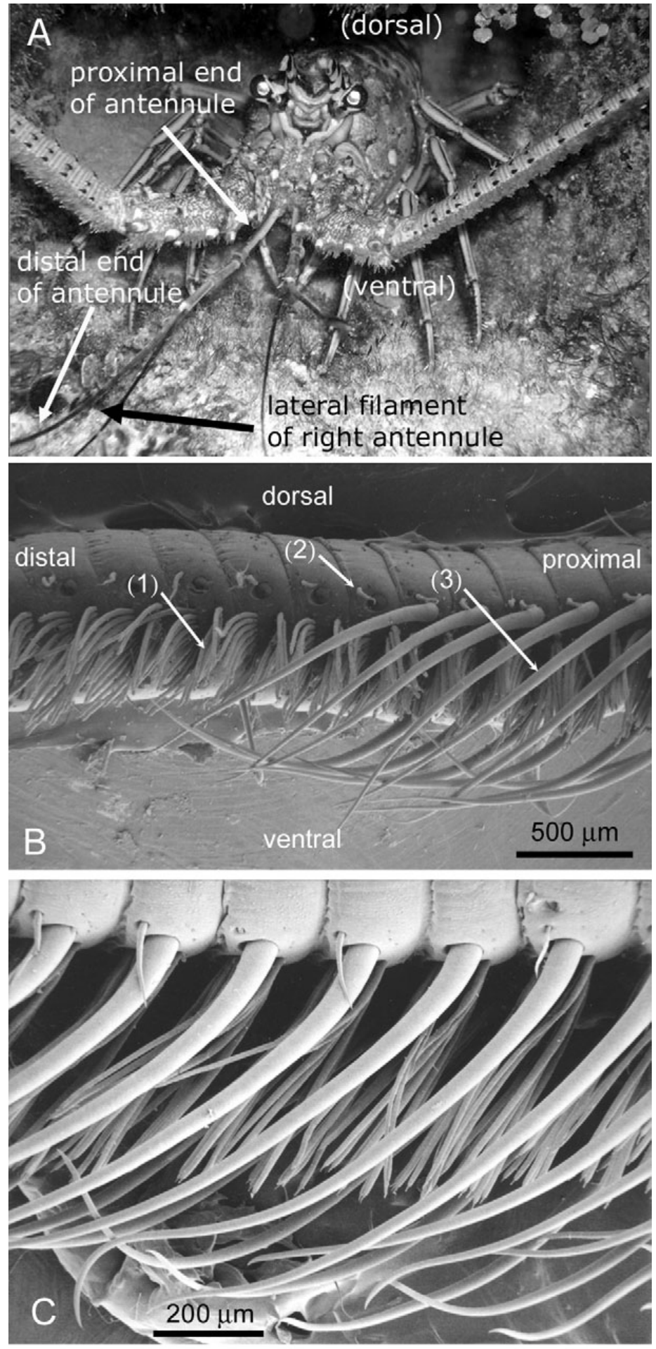
Aesthetasc arrays organize the olfactory interface
Aesthetascs are thin-walled sensory hairs bearing the outer dendrites of olfactory receptor neurons. On a Panulirus lateral antennular flagellum, they occur in repeated rows bordered by larger guard hairs. The scanning electron micrographs reveal a structured array rather than a uniformly exposed sensory surface.
Reidenbach, George and Koehl measured biological geometry before constructing physical models. Representative aesthetasc diameter was 22 µm, length about 720 µm, and spacing about 60 µm. The hairs are arranged at an offset angle, allowing appendage orientation to influence the water entering their gaps.
Chemical detection requires molecules to reach this sensory interface before membrane receptors can respond. Guard hairs and row spacing set the gaps through which water and odor molecules enter, so the hydrodynamics of the array can be measured directly.
Reidenbach et al. (2008), Fig. 1A–C. Spiny lobster photograph and antennular scanning electron micrographs.
Reidenbach et al. (2008)
15
Notes:
• Aesthetascs are thin-walled sensory hairs bearing the outer dendrites of olfactory receptor neurons. On a Panulirus lateral antennular flagellum, they occur in repeated rows bordered by larger guard hairs. The scanning electron micrographs reveal a structured array rather than a uniformly exposed sensory surface.
– An outer dendrite is the distal sensory portion of a neuron extending into the hair. The hair’s cuticle and fluid environment are part of the path between transported chemicals and neuronal membrane receptors.
• Reidenbach, George and Koehl measured biological geometry before constructing physical models. Representative aesthetasc diameter was 22 µm, length about 720 µm, and spacing about 60 µm. The hairs are arranged at an offset angle, allowing appendage orientation to influence the water entering their gaps.
• Chemical detection requires molecules to reach this sensory interface before membrane receptors can respond. Guard hairs and row spacing set the gaps through which water and odor molecules enter, so the hydrodynamics of the array can be measured directly.
References:
Reidenbach MA, George NT, Koehl MAR (2008). Antennule morphology and flicking kinematics facilitate odor sampling by the spiny lobster, Panulirus argus. Journal of Experimental Biology 211(17):2849-2858. https://doi.org/10.1242/jeb.016394
Figure: Reidenbach et al. (2008), Fig. 1A–C. Spiny lobster photograph and antennular scanning electron micrographs.
Figure source: https://doi.org/10.1242/jeb.016394

Slide 21
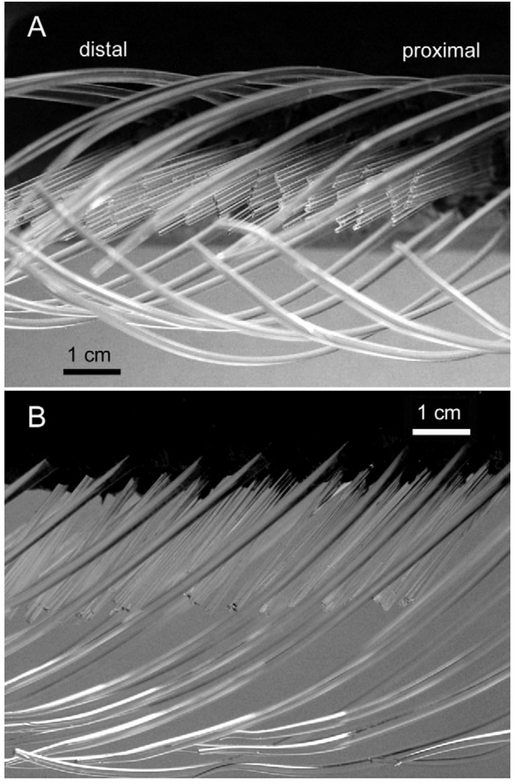
Scaled physical models isolate hair-array hydrodynamics
A dynamically scaled model reproduces the important balance of fluid forces despite using enlarged structures and a different fluid. Reidenbach and colleagues built glass-rod hair arrays in mineral oil and matched the Reynolds number, the ratio of inertial to viscous effects relevant to flow.
Biological dimensions and flicking motions constrained the model geometry. Particle-image velocimetry, or PIV, tracked suspended particles between images to measure fluid velocity around and between hairs. The investigators varied orientation, speed and guard-hair presence while retaining the remaining preparation.
These controlled changes identify mechanical causes of water exchange that are difficult to measure inside a living hair array. Varying orientation, speed and guard-hair presence reveals how array geometry sets the delivery of fresh water to the aesthetasc surfaces.
Reidenbach et al. (2008), Fig. 3A–B. Ventral and side photographs of the dynamically scaled physical hair-array model.
Horner et al. (2004), Fig. 1B. Scanning electron micrograph of aesthetasc and guard hairs.
Reidenbach et al. (2008); Horner et al. (2004)
16
Notes:
• A dynamically scaled model reproduces the important balance of fluid forces despite using enlarged structures and a different fluid. Reidenbach and colleagues built glass-rod hair arrays in mineral oil and matched the Reynolds number, the ratio of inertial to viscous effects relevant to flow.
– Matching Reynolds number preserves the relative influence of inertia and viscosity. It does not automatically reproduce every chemical property, molecular diffusion rate or feature of a living appendage.
• Biological dimensions and flicking motions constrained the model geometry. Particle-image velocimetry, or PIV, tracked suspended particles between images to measure fluid velocity around and between hairs. The investigators varied orientation, speed and guard-hair presence while retaining the remaining preparation.
• These controlled changes identify mechanical causes of water exchange that are difficult to measure inside a living hair array. Varying orientation, speed and guard-hair presence reveals how array geometry sets the delivery of fresh water to the aesthetasc surfaces.
References:
Reidenbach MA, George NT, Koehl MAR (2008). Antennule morphology and flicking kinematics facilitate odor sampling by the spiny lobster, Panulirus argus. Journal of Experimental Biology 211(17):2849-2858. https://doi.org/10.1242/jeb.016394
Horner AJ, Weissburg MJ, Derby CD (2004). Dual antennular chemosensory pathways can mediate orientation by Caribbean spiny lobsters in naturalistic flow conditions. Journal of Experimental Biology 207(21):3785-3796. https://doi.org/10.1242/jeb.01200
Figure: Reidenbach et al. (2008), Fig. 3A–B. Ventral and side photographs of the dynamically scaled physical hair-array model.
Figure source: https://doi.org/10.1242/jeb.016394
Figure: Horner et al. (2004), Fig. 1B. Scanning electron micrograph of aesthetasc and guard hairs.
Figure source: https://doi.org/10.1242/jeb.01200

Slide 22
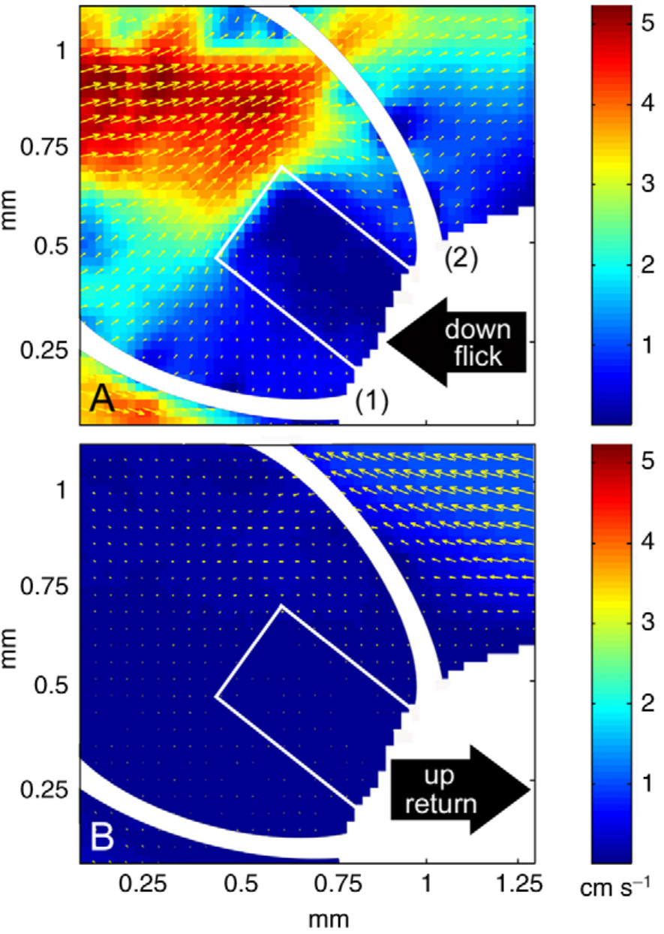
The fast downstroke replaces water between hairs
An antennular flick consists of a fast downward movement followed by a slower return. In the scaled-model study, PIV measured water velocity inside the hair array during the downstroke. The published color map reports velocity rather than chemical concentration or sensory-neuron activity.
During the fast movement, water penetrated the aesthetasc gaps and replaced the previously retained sample. Measured profiles were comparatively uniform across the array. Separate high-speed recordings placed downstroke motion near an aesthetasc Reynolds number of 2, compared with about 0.5 during return.
The sensory organ therefore controls exposure mechanically before a receptor opens. Fresh water entering the gaps delivers new odor molecules to the aesthetasc surfaces with each downstroke.
Reidenbach et al. (2008), Fig. 5A–B. Measured particle-image-velocimetry flow during the downstroke.
Horner et al. (2004), Fig. 1B. Scanning electron micrograph of aesthetasc and guard hairs.
Reidenbach et al. (2008); Horner et al. (2004); Goldman & Koehl (2001)
17
Notes:
• An antennular flick consists of a fast downward movement followed by a slower return. In the scaled-model study, PIV measured water velocity inside the hair array during the downstroke. The published color map reports velocity rather than chemical concentration or sensory-neuron activity.
– The reference frame matters: water flowing relative to a moving hair is the delivery variable. An ambient current and the appendage’s own movement can both contribute to that relative motion.
• During the fast movement, water penetrated the aesthetasc gaps and replaced the previously retained sample. Measured profiles were comparatively uniform across the array. Separate high-speed recordings placed downstroke motion near an aesthetasc Reynolds number of 2, compared with about 0.5 during return.
• The sensory organ therefore controls exposure mechanically before a receptor opens. Fresh water entering the gaps delivers new odor molecules to the aesthetasc surfaces with each downstroke.
References:
Reidenbach MA, George NT, Koehl MAR (2008). Antennule morphology and flicking kinematics facilitate odor sampling by the spiny lobster, Panulirus argus. Journal of Experimental Biology 211(17):2849-2858. https://doi.org/10.1242/jeb.016394
Horner AJ, Weissburg MJ, Derby CD (2004). Dual antennular chemosensory pathways can mediate orientation by Caribbean spiny lobsters in naturalistic flow conditions. Journal of Experimental Biology 207(21):3785-3796. https://doi.org/10.1242/jeb.01200
Goldman JA, Koehl MAR (2001). Fluid Dynamic Design of Lobster Olfactory Organs: High Speed Kinematic Analysis of Antennule Flicking by Panulirus argus. Chemical Senses 26(4):385-398. https://doi.org/10.1093/chemse/26.4.385
Figure: Reidenbach et al. (2008), Fig. 5A–B. Measured particle-image-velocimetry flow during the downstroke.
Figure source: https://doi.org/10.1242/jeb.016394
Figure: Horner et al. (2004), Fig. 1B. Scanning electron micrograph of aesthetasc and guard hairs.
Figure source: https://doi.org/10.1242/jeb.01200

Slide 23
The Reynolds number sets how water moves through hairs
The Reynolds number is the ratio of inertial to viscous forces in a flow. Low values mean that viscosity dominates and water resists moving through narrow gaps, whereas higher values mean that water moves through more freely.
Reidenbach and colleagues built enlarged glass-rod hair arrays in mineral oil and matched the Reynolds number of the real organ. High-speed recordings placed the aesthetasc Reynolds number near 2 during the downstroke, compared with about 0.5 during the slower return.
The higher value during the downstroke corresponds to water penetrating the gaps and replacing the retained sample. The lower value during return corresponds to reduced leakiness, so the array holds its captured water. Matching the Reynolds number makes the enlarged model a valid stand-in for the animal.
Reidenbach et al. (2008), Fig. 5A–B. Measured particle-image-velocimetry flow during the downstroke.
Horner et al. (2004), Fig. 1B. Scanning electron micrograph of aesthetasc and guard hairs.
Reidenbach et al. (2008); Horner et al. (2004); Goldman & Koehl (2001)
17a
Notes:
• The Reynolds number explains why a hair array can sniff.
• Definition.
– The Reynolds number is the ratio of inertial to viscous forces.
– Viscosity dominates at low values.
• Scaled model.
– Glass-rod hair arrays in mineral oil were enlarged.
– The Reynolds number was matched to the real organ.
• Downstroke.
– The aesthetasc Reynolds number was near 2 during the fast downstroke.
– Water penetrated the gaps and replaced the retained sample.
• Return.
– The value was about 0.5 during the slower return.
– Leakiness decreased and the sample was held.
• Measurement.
– Separate high-speed recordings estimated the movement of the animal.
• Meaning.
– Matching the Reynolds number allows an enlarged model to reproduce the balance of fluid forces in the real hairs.
• Where the number comes from.
– It depends on the size of the hairs, their speed and the viscosity of the fluid.
• Why a model works.
– A larger structure moving in a thicker fluid can have the same Reynolds number as a small structure in water.
– The balance of forces is then the same.
References:
Reidenbach MA, George NT, Koehl MAR (2008). Antennule morphology and flicking kinematics facilitate odor sampling by the spiny lobster, Panulirus argus. Journal of Experimental Biology 211(17):2849-2858. https://doi.org/10.1242/jeb.016394
Goldman JA, Koehl MAR (2001). Fluid Dynamic Design of Lobster Olfactory Organs: High Speed Kinematic Analysis of Antennule Flicking by Panulirus argus. Chemical Senses 26(4):385-398. https://doi.org/10.1093/chemse/26.4.385

Slide 24
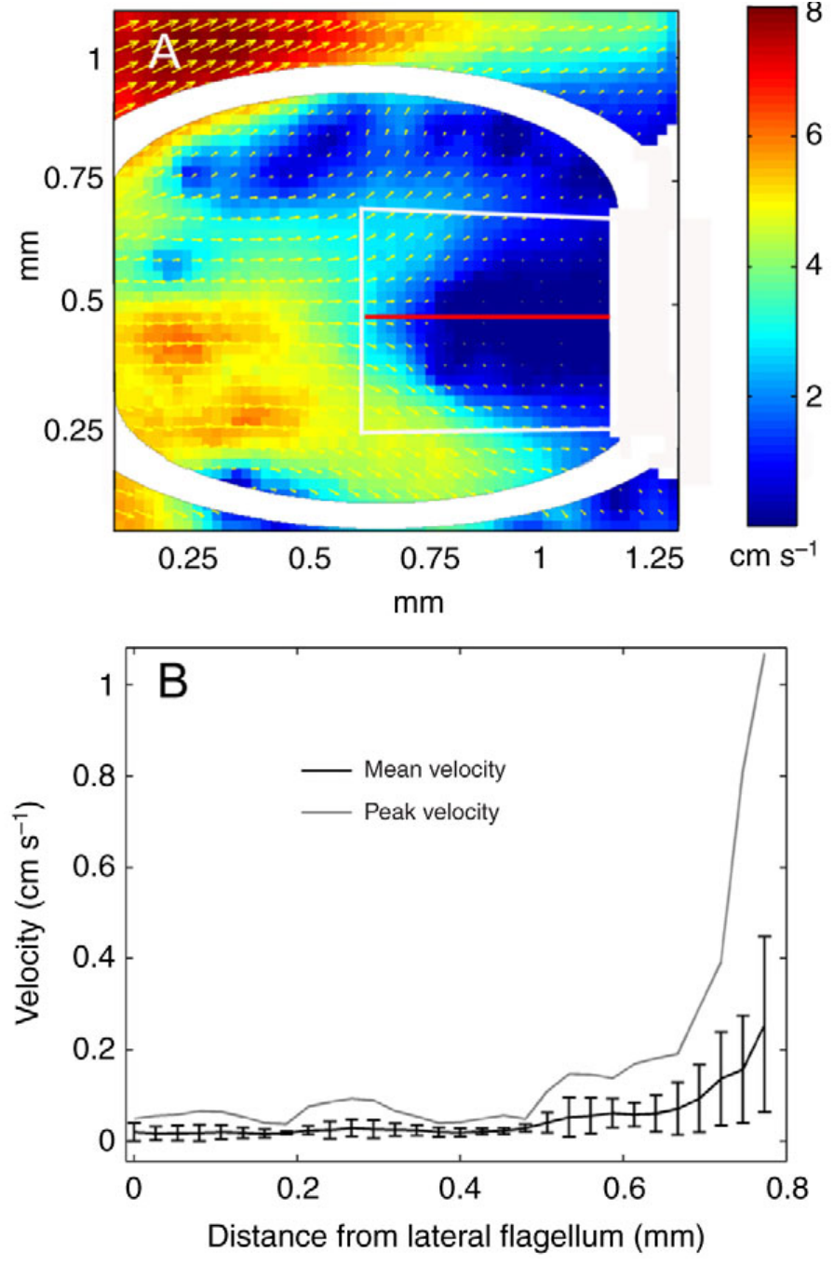
The slow return retains a chemical sample
Leakiness describes the extent to which water passes through a hair array rather than around it. Reidenbach and colleagues compared measured downstroke and return-stroke flow. The slower return reduced penetration, allowing the captured water to remain near the aesthetasc surfaces.
Return motion was approximately one-quarter of downstroke speed, yet water between hairs moved about 25 times more slowly. The nonlinear change shows that reducing appendage speed can alter array permeability much more than it alters the movement of the appendage itself.
Retention creates time for molecular diffusion toward the sensory surface. The authors estimated that diffusion over 0.5 s could span about 32 µm, which gives molecules in the retained water time to reach the aesthetasc surfaces during a slow return.
Reidenbach et al. (2008), Fig. 9A–B. Measured slow-return flow field and velocity profile.
Horner et al. (2004), Fig. 1B. Scanning electron micrograph of aesthetasc and guard hairs.
Reidenbach et al. (2008); Horner et al. (2004)
18
Notes:
• Leakiness describes the extent to which water passes through a hair array rather than around it. Reidenbach and colleagues compared measured downstroke and return-stroke flow. The slower return reduced penetration, allowing the captured water to remain near the aesthetasc surfaces.
– Diffusion is random molecular motion that redistributes solute down local concentration differences. Retaining water near a hair increases available contact time, but does not guarantee that all retained molecules reach the membrane.
• Return motion was approximately one-quarter of downstroke speed, yet water between hairs moved about 25 times more slowly. The nonlinear change shows that reducing appendage speed can alter array permeability much more than it alters the movement of the appendage itself.
• Retention creates time for molecular diffusion toward the sensory surface. The authors estimated that diffusion over 0.5 s could span about 32 µm, which gives molecules in the retained water time to reach the aesthetasc surfaces during a slow return.
References:
Reidenbach MA, George NT, Koehl MAR (2008). Antennule morphology and flicking kinematics facilitate odor sampling by the spiny lobster, Panulirus argus. Journal of Experimental Biology 211(17):2849-2858. https://doi.org/10.1242/jeb.016394
Horner AJ, Weissburg MJ, Derby CD (2004). Dual antennular chemosensory pathways can mediate orientation by Caribbean spiny lobsters in naturalistic flow conditions. Journal of Experimental Biology 207(21):3785-3796. https://doi.org/10.1242/jeb.01200
Figure: Reidenbach et al. (2008), Fig. 9A–B. Measured slow-return flow field and velocity profile.
Figure source: https://doi.org/10.1242/jeb.016394
Figure: Horner et al. (2004), Fig. 1B. Scanning electron micrograph of aesthetasc and guard hairs.
Figure source: https://doi.org/10.1242/jeb.01200

Slide 25
Diffusion carries molecules to the sensory surface
Diffusion is the spread of molecules from regions of high concentration to regions of low concentration through random motion, without bulk flow of the water. Over short distances it moves odor molecules toward a surface effectively.
Reidenbach and colleagues measured the slow return at about one-quarter of downstroke speed, yet water between hairs moved about 25 times more slowly. The authors estimated that diffusion over 0.5 s could span about 32 µm. Aesthetasc spacing was about 60 µm.
Retained water that moves slowly gives molecules time to reach the aesthetasc surface by diffusion. The slow return therefore turns a captured sample into an exposure that lasts long enough for molecules to arrive at the sensory dendrites.
Reidenbach et al. (2008), Fig. 9A–B. Measured slow-return flow field and velocity profile.
Horner et al. (2004), Fig. 1B. Scanning electron micrograph of aesthetasc and guard hairs.
Reidenbach et al. (2008); Horner et al. (2004)
18a
Notes:
• Diffusion is the last step of odor delivery to a hair.
• Definition.
– Diffusion is the spread of molecules through random motion.
– It occurs without bulk flow of the water.
• Retained water.
– The slow return keeps a sample near the aesthetasc surfaces.
• Speeds.
– Return motion was approximately one-quarter of downstroke speed.
– Water between hairs moved about 25 times more slowly.
• Diffusion distance.
– The authors estimated that diffusion over 0.5 seconds could span about 32 micrometers.
– Aesthetasc spacing was about 60 micrometers.
• Calculation.
– The estimate is a physical calculation and not a measured uptake by neurons.
• Meaning.
– Slow water gives molecules time to arrive at the sensory dendrites.
• Leakiness.
– Leakiness describes how much water passes through the array and not around it.
– The slow return reduced penetration.
• Nonlinear change.
– A fourfold change in appendage speed produced a 25-fold change in speed between hairs.
– Array permeability therefore depends strongly on speed.
• Retention.
– Water captured during the downstroke stays between hairs while the surrounding plume continues to move.
– The antennule therefore holds a sample of plume water during the slow return.
– A later downstroke replaces that sample with new water.
References:
Reidenbach MA, George NT, Koehl MAR (2008). Antennule morphology and flicking kinematics facilitate odor sampling by the spiny lobster, Panulirus argus. Journal of Experimental Biology 211(17):2849-2858. https://doi.org/10.1242/jeb.016394

Slide 26
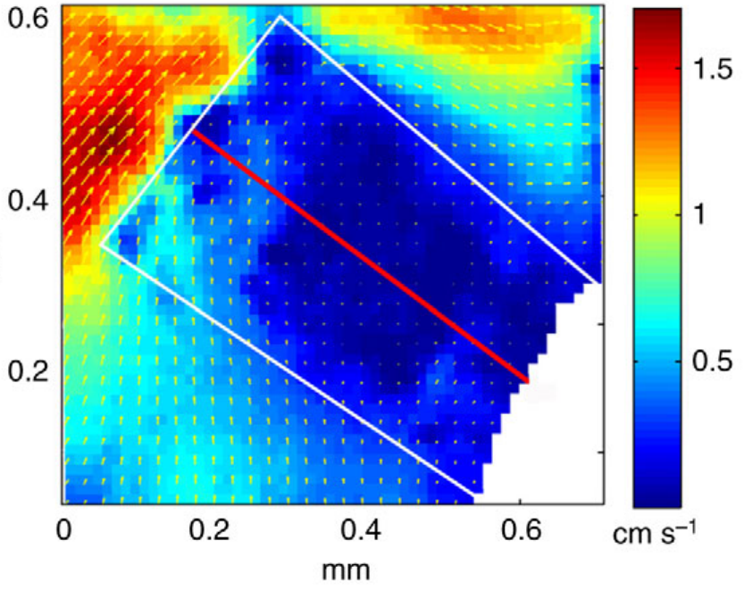
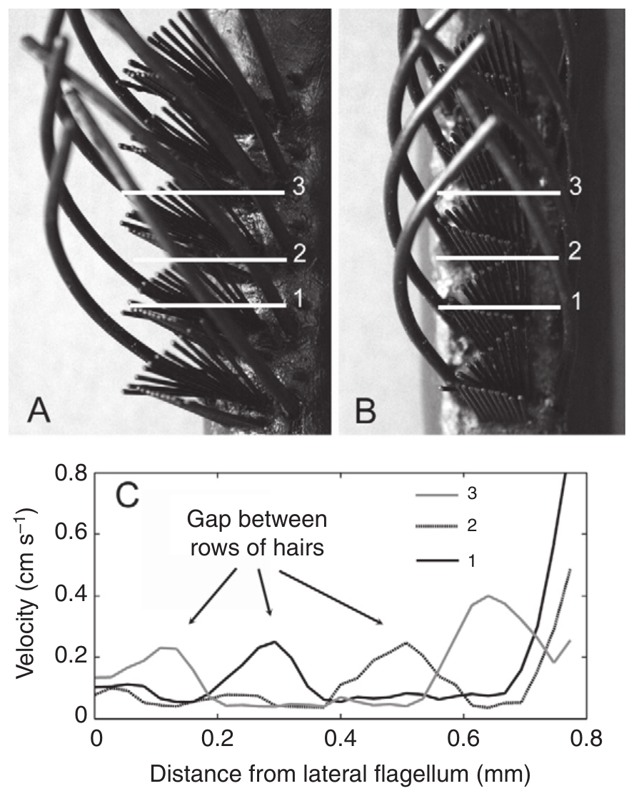
Hair orientation and guard hairs alter delivery
The shape and orientation of an aesthetasc array determine how incident water moves through it. Reidenbach and colleagues compared the observed zigzag orientation, offset by about 32°, with a zero-degree arrangement. They also measured arrays with and without surrounding guard hairs.
The observed orientation produced relatively uniform water penetration during the flick. Guard-hair removal changed the spatial velocity profile, revealing a hydrodynamic contribution beyond a possible protective role. The controlled physical model isolated these geometry effects without altering neuronal excitability.
The findings link anatomical arrangement to the distribution of a fresh sensory sample. Zigzag orientation and guard hairs shape the spatial velocity profile of water in the array, which sets how evenly each hair receives fresh sample.
Reidenbach et al. (2008), Fig. 6. Measured flow through a zigzag array in its observed orientation.
Reidenbach et al. (2008), Fig. 7A–C. Hair-array photographs and measured velocity with guard hairs present or removed.
Reidenbach et al. (2008)
19
Notes:
• The shape and orientation of an aesthetasc array determine how incident water moves through it. Reidenbach and colleagues compared the observed zigzag orientation, offset by about 32°, with a zero-degree arrangement. They also measured arrays with and without surrounding guard hairs.
– The source’s colored velocity map is a measurement from the original physical model. Its bright regions show faster relative flow, not stronger neural activity or more receptor expression.
• The observed orientation produced relatively uniform water penetration during the flick. Guard-hair removal changed the spatial velocity profile, revealing a hydrodynamic contribution beyond a possible protective role. The controlled physical model isolated these geometry effects without altering neuronal excitability.
• The findings link anatomical arrangement to the distribution of a fresh sensory sample. Zigzag orientation and guard hairs shape the spatial velocity profile of water in the array, which sets how evenly each hair receives fresh sample.
References:
Reidenbach MA, George NT, Koehl MAR (2008). Antennule morphology and flicking kinematics facilitate odor sampling by the spiny lobster, Panulirus argus. Journal of Experimental Biology 211(17):2849-2858. https://doi.org/10.1242/jeb.016394
Figure: Reidenbach et al. (2008), Fig. 6. Measured flow through a zigzag array in its observed orientation.
Figure source: https://doi.org/10.1242/jeb.016394
Figure: Reidenbach et al. (2008), Fig. 7A–C. Hair-array photographs and measured velocity with guard hairs present or removed.
Figure source: https://doi.org/10.1242/jeb.016394

Slide 27
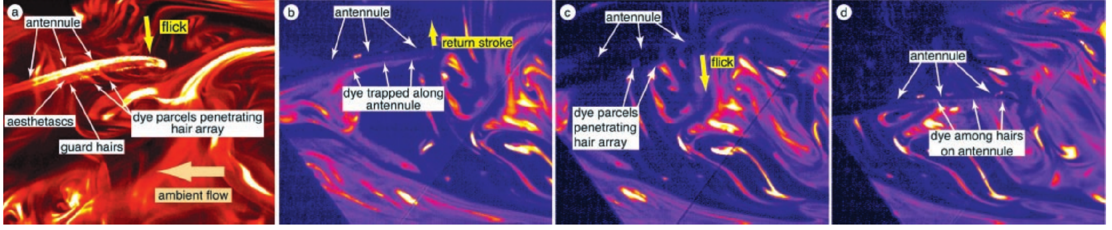
Published video directly reveals lobster sniffing
Koehl and colleagues programmed a mechanical lobster to flick real Panulirus antennules in a fluorescent dye plume. This preparation retained the biological hair array while controlling movement. Dye released from a benthic source 1 m upstream represented chemicals carried from a food source.
The original high-speed frames show approximately 1-mm-thick dye parcels entering the array during the rapid downstroke. During the slower return, dye remained trapped between hairs while the surrounding plume continued moving. A later downstroke shed that sample and captured another.
The observation directly supports discrete water sampling rather than uninterrupted exposure to ambient concentration. Each downstroke captures a new parcel of plume water and each slow return holds it, so the antennule samples in discrete steps matched to its flick cycle.
Koehl et al. (2001), Fig. 1A–D. Original video frames of dye capture and retention during flicking.
Koehl et al. (2001)
20
Notes:
• Koehl and colleagues programmed a mechanical lobster to flick real Panulirus antennules in a fluorescent dye plume. This preparation retained the biological hair array while controlling movement. Dye released from a benthic source 1 m upstream represented chemicals carried from a food source.
– The image sequence contains successive frames, not a diagram created for this lecture. Tracking the same dye feature distinguishes exchange with the surrounding plume from simple movement of the appendage.
• The original high-speed frames show approximately 1-mm-thick dye parcels entering the array during the rapid downstroke. During the slower return, dye remained trapped between hairs while the surrounding plume continued moving. A later downstroke shed that sample and captured another.
• The observation directly supports discrete water sampling rather than uninterrupted exposure to ambient concentration. Each downstroke captures a new parcel of plume water and each slow return holds it, so the antennule samples in discrete steps matched to its flick cycle.
References:
Koehl MAR, Koseff JR, Crimaldi JP, McCay MG, Cooper T, Wiley MB, Moore PA (2001). Lobster Sniffing: Antennule Design and Hydrodynamic Filtering of Information in an Odor Plume. Science 294(5548):1948-1951. https://doi.org/10.1126/science.1063724
Figure: Koehl et al. (2001), Fig. 1A–D. Original video frames of dye capture and retention during flicking.
Figure source: https://doi.org/10.1126/science.1063724

Slide 28
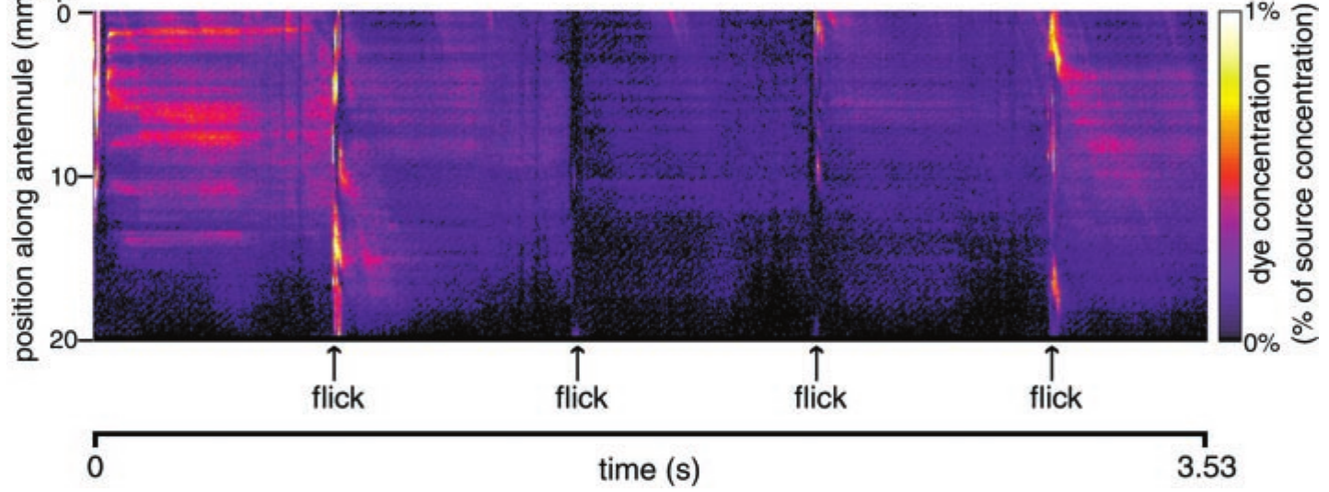
A captured sample preserves spatial information briefly
Koehl and colleagues measured concentration along the aesthetasc-bearing section of the antennule through successive video frames. Their published spatiotemporal map places position on one axis and time on the other, with color representing measured dye concentration at each position.
The pattern changed during rapid downstrokes but remained comparatively stable during slower return and stationary intervals. Dye could spread along the antennule during acquisition, so the captured pattern was not an exact unchanged slice of the original plume. Sampling both retains and filters information.
This physical filtering precedes neuronal transduction. A spatially nonuniform retained sample can stimulate different sensory endings differently, so mechanical retention shapes the pattern of input along the antennule before any neuron responds.
Koehl et al. (2001), Fig. 2. Measured spatial dye pattern retained between successive flicks.
Koehl et al. (2001)
21
Notes:
• Koehl and colleagues measured concentration along the aesthetasc-bearing section of the antennule through successive video frames. Their published spatiotemporal map places position on one axis and time on the other, with color representing measured dye concentration at each position.
– A horizontal streak in the published map means concentration at one position remained similar over time. It should not be interpreted as a sustained spike train or a labeled sensory axon.
• The pattern changed during rapid downstrokes but remained comparatively stable during slower return and stationary intervals. Dye could spread along the antennule during acquisition, so the captured pattern was not an exact unchanged slice of the original plume. Sampling both retains and filters information.
• This physical filtering precedes neuronal transduction. A spatially nonuniform retained sample can stimulate different sensory endings differently, so mechanical retention shapes the pattern of input along the antennule before any neuron responds.
References:
Koehl MAR, Koseff JR, Crimaldi JP, McCay MG, Cooper T, Wiley MB, Moore PA (2001). Lobster Sniffing: Antennule Design and Hydrodynamic Filtering of Information in an Odor Plume. Science 294(5548):1948-1951. https://doi.org/10.1126/science.1063724
Figure: Koehl et al. (2001), Fig. 2. Measured spatial dye pattern retained between successive flicks.
Figure source: https://doi.org/10.1126/science.1063724

Slide 29
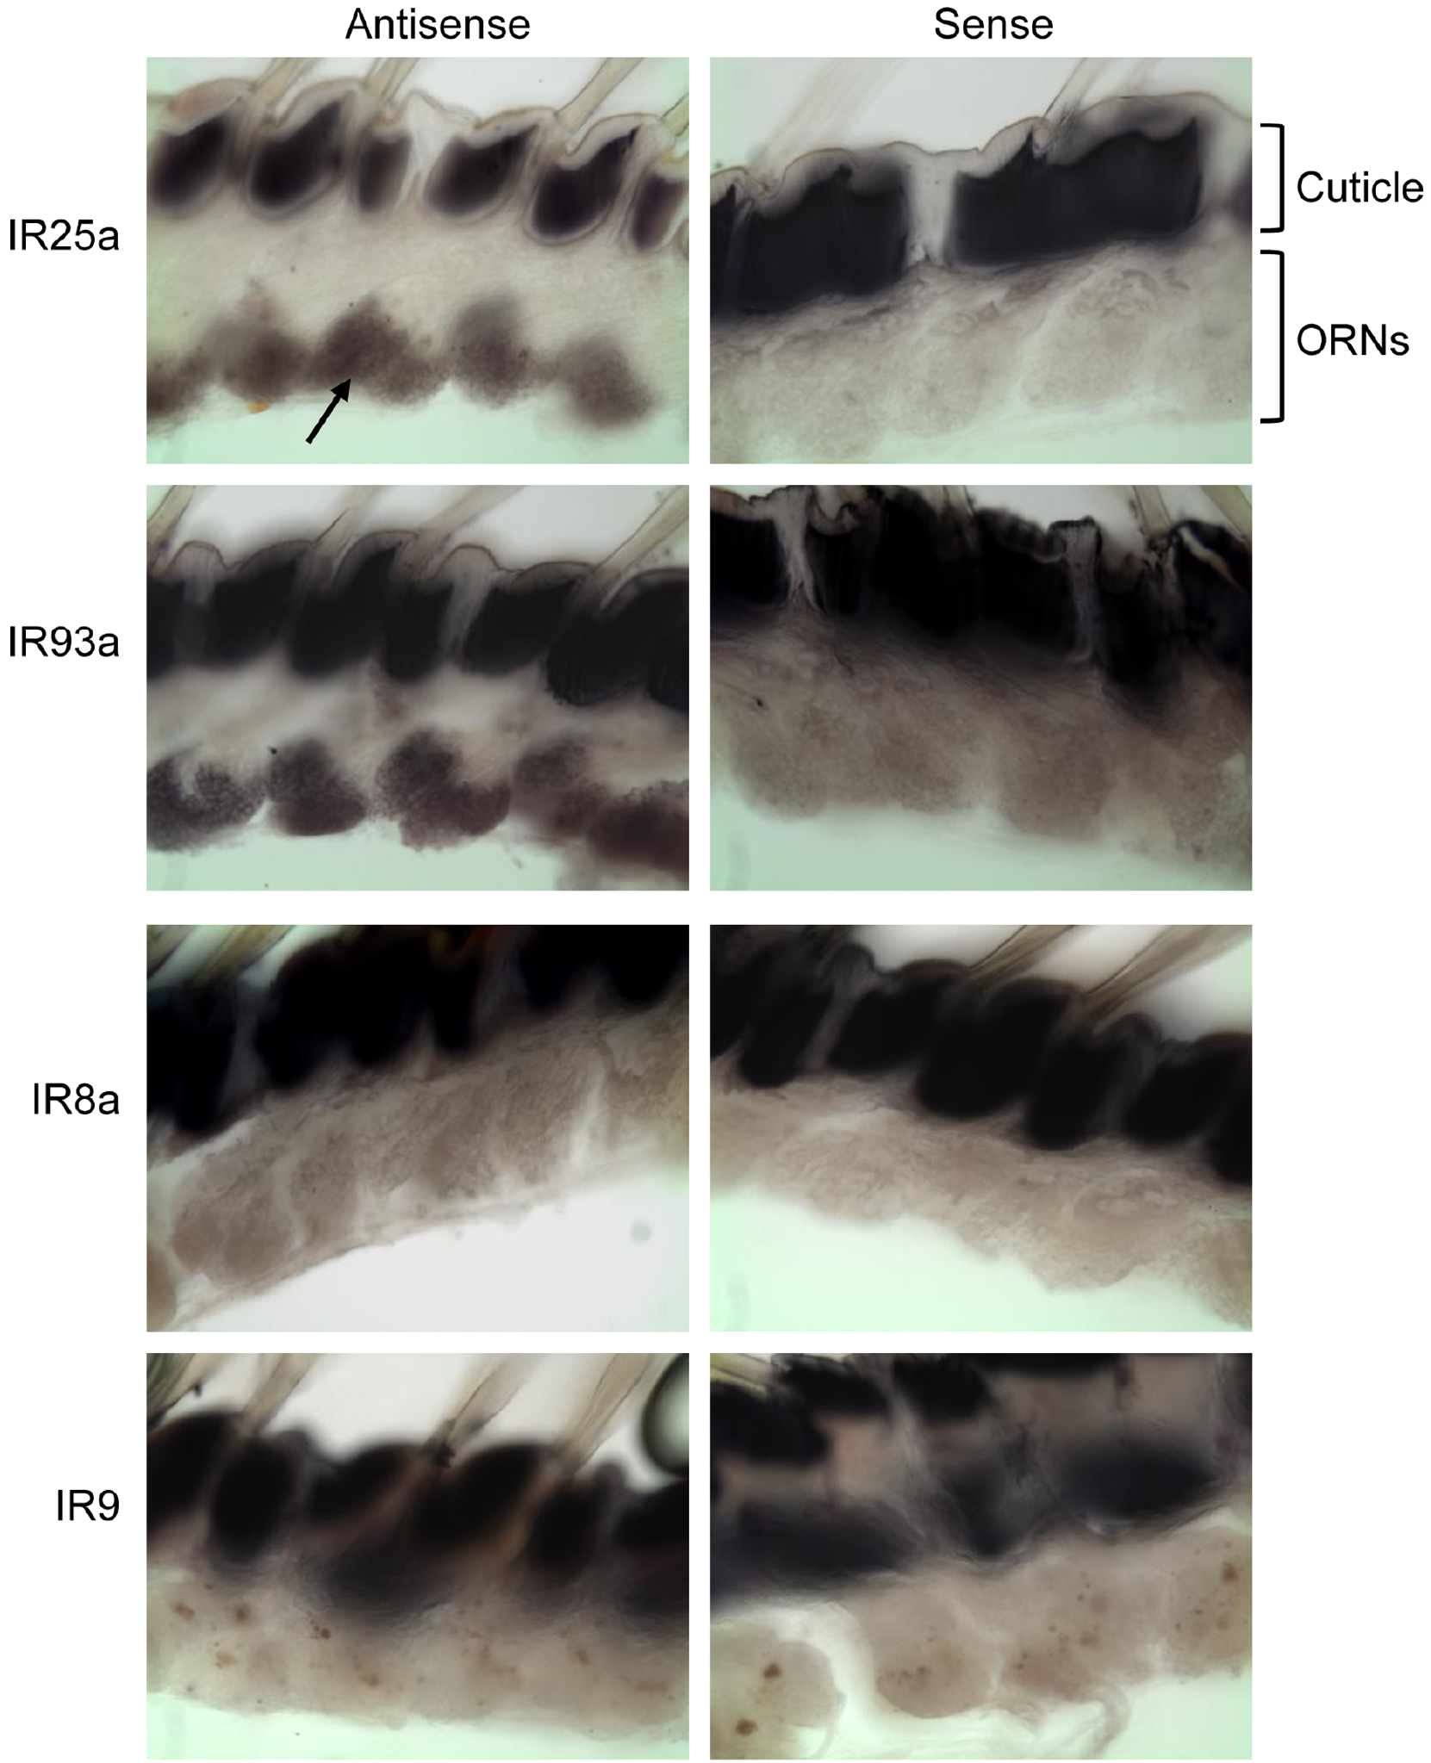
Ionotropic-receptor genes occur in olfactory neurons
Ionotropic receptors, or IRs, are chemosensory proteins related to ionotropic glutamate receptors, a family of ligand-gated membrane channels. Corey and colleagues identified candidate IR sequences in Panulirus olfactory tissue and used in situ hybridization to locate their RNA within sensory cells.
IR25a and IR93a signals occurred broadly in olfactory receptor neurons. Antisense probes detect complementary target RNA; sense probes supplied negative controls for nonspecific staining. IR8a and another candidate showed more restricted expression, suggesting common components alongside more variable receptor populations.
The findings support an IR-based molecular architecture in lobster olfaction. Staining of the neurons themselves places candidate receptor RNA in the cells that detect odor.
Corey et al. (2013), Fig. 2. Receptor RNA localization with antisense and sense-probe controls.
Corey et al. (2013)
22
Notes:
• Ionotropic receptors, or IRs, are chemosensory proteins related to ionotropic glutamate receptors, a family of ligand-gated membrane channels. Corey and colleagues identified candidate IR sequences in Panulirus olfactory tissue and used in situ hybridization to locate their RNA within sensory cells.
– An ionotropic glutamate receptor detects glutamate in its established synaptic role. A related chemosensory IR need not recognize glutamate merely because it shares part of that receptor’s sequence and predicted structure.
• IR25a and IR93a signals occurred broadly in olfactory receptor neurons. Antisense probes detect complementary target RNA; sense probes supplied negative controls for nonspecific staining. IR8a and another candidate showed more restricted expression, suggesting common components alongside more variable receptor populations.
• The findings support an IR-based molecular architecture in lobster olfaction. Staining of the neurons themselves places candidate receptor RNA in the cells that detect odor.
References:
Corey EA, Bobkov Y, Ukhanov K, Ache BW (2013). Ionotropic Crustacean Olfactory Receptors. PLoS ONE 8(4):e60551. https://doi.org/10.1371/journal.pone.0060551
Figure: Corey et al. (2013), Fig. 2. Receptor RNA localization with antisense and sense-probe controls.
Figure source: https://doi.org/10.1371/journal.pone.0060551

Slide 30
In situ hybridization maps RNA in tissue
In situ hybridization uses a labeled probe that base-pairs with a complementary RNA sequence to reveal which cells in a tissue section express a gene. An antisense probe detects the target RNA, whereas a sense probe supplies a negative control for nonspecific staining.
Corey and colleagues identified candidate ionotropic-receptor sequences in Panulirus olfactory tissue and applied probes to sections. IR25a and IR93a signals occurred broadly in olfactory receptor neurons, whereas IR8a and another candidate showed more restricted expression.
Signal in the sensory neurons places candidate receptor RNA in the cells that detect odor. Broad labeling of IR25a and IR93a marks components common to many neurons, and restricted labeling marks candidates that vary between receptor populations.
Corey et al. (2013), Fig. 2. Receptor RNA localization with antisense and sense-probe controls.
Corey et al. (2013)
22a
Notes:
• In situ hybridization shows which cells carry a given RNA.
• Method.
– A labeled probe base-pairs with a complementary RNA sequence.
– The label marks the cells that contain the RNA.
• Controls.
– Antisense probes detect the target RNA.
– Sense probes supply a negative control for nonspecific staining.
• Candidates.
– Ionotropic receptors are related to ionotropic glutamate receptors.
– Candidate sequences were identified in Panulirus olfactory tissue.
• Broad signals.
– IR25a and IR93a occurred broadly in olfactory receptor neurons.
• Restricted signals.
– IR8a and another candidate showed more restricted expression.
• Meaning.
– Common components appear alongside more variable receptor populations.
• Candidates.
– Candidate sequences were identified before the probes were made.
– The probes were designed to match these sequences.
• Cell location.
– Staining occurred within sensory cells and not in surrounding tissue.
• Why probes need controls.
– Probes can stick to tissue without matching a target.
– The sense probe has the same sequence as the RNA and cannot pair with it.
– Staining with the sense probe would reveal nonspecific labeling.
References:
Corey EA, Bobkov Y, Ukhanov K, Ache BW (2013). Ionotropic Crustacean Olfactory Receptors. PLoS ONE 8(4):e60551. https://doi.org/10.1371/journal.pone.0060551

Slide 31
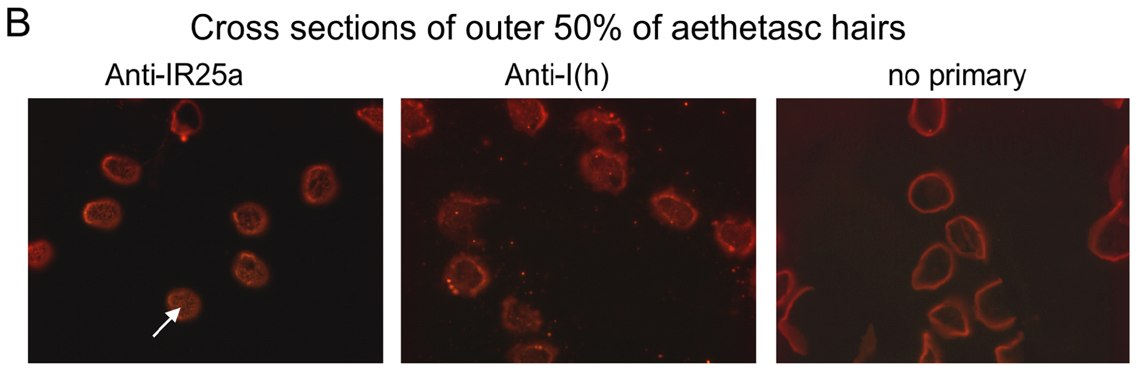
Receptor protein reaches the sensory dendrites
RNA expression shows which cells make a transcript, but the location of the protein must be measured directly. Corey and colleagues used an antibody against IR25a to determine where the protein sits. Cross-sections through distal aesthetasc hairs gave anatomical access to the outer dendrites, where transported odorants first approach olfactory neurons, so the antibody could be tested at the site of first contact with odor.
IR25a immunofluorescence appeared within the dendritic profiles. Sections stained without the primary antibody provided a background control, and an antibody against an Ih-channel protein served as a separate neuronal comparison. Western blots also detected a band near the predicted IR25a molecular mass of about 100 kDa, linking the staining to a protein of the expected size.
Biochemical detection and dendritic staining converge on one site, which places a candidate receptor component where odorants first meet olfactory neurons. The band near the predicted mass matches the expected size of the protein, so the two lines of evidence support the same molecule in the same compartment, and the signal for the receptor is placed at the point of first contact.
Corey et al. (2013), Fig. 4B, fluorescent row and original labels. IR25a immunofluorescence in aesthetasc dendrites with control labels intact.
Corey et al. (2013)
23
Notes:
• RNA expression alone does not show where the resulting protein acts. Corey and colleagues used an antibody against IR25a to test its localization. Cross-sections through distal aesthetasc hairs supplied anatomical access to the outer dendrites, where transported odorants first approach olfactory neurons.
– A kilodalton is a unit of molecular mass. Western-band size supports protein identity, while the section image addresses its anatomical location; neither alone measures an ion channel opening.
• IR25a immunofluorescence occurred within the dendritic profiles. Sections stained without the primary antibody supplied a background control, and an antibody recognizing an Ih-channel protein provided a separate neuronal comparison. Western blots also detected a band near the predicted IR25a molecular mass of approximately 100 kDa.
• The convergence of biochemical detection and dendritic staining places a candidate receptor component at a plausible transduction site. Dendritic staining places IR25a in the compartment that first meets odorants carried into the hair, and the band near the predicted mass matches the expected protein.
References:
Corey EA, Bobkov Y, Ukhanov K, Ache BW (2013). Ionotropic Crustacean Olfactory Receptors. PLoS ONE 8(4):e60551. https://doi.org/10.1371/journal.pone.0060551
Figure: Corey et al. (2013), Fig. 4B, fluorescent row and original labels. IR25a immunofluorescence in aesthetasc dendrites with control labels intact.
Figure source: https://doi.org/10.1371/journal.pone.0060551

Slide 32
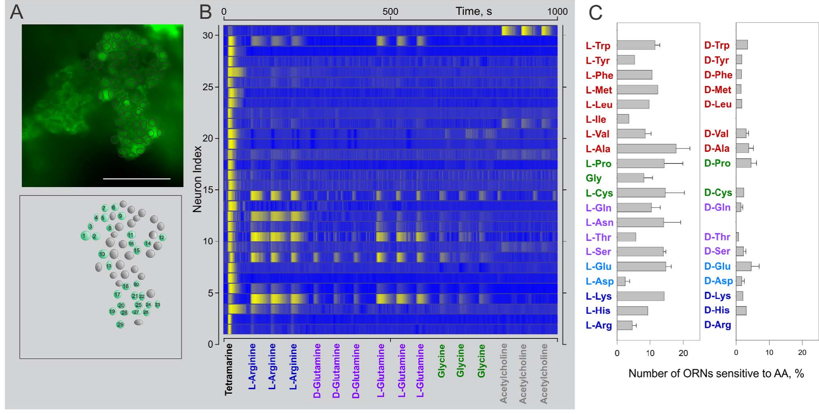
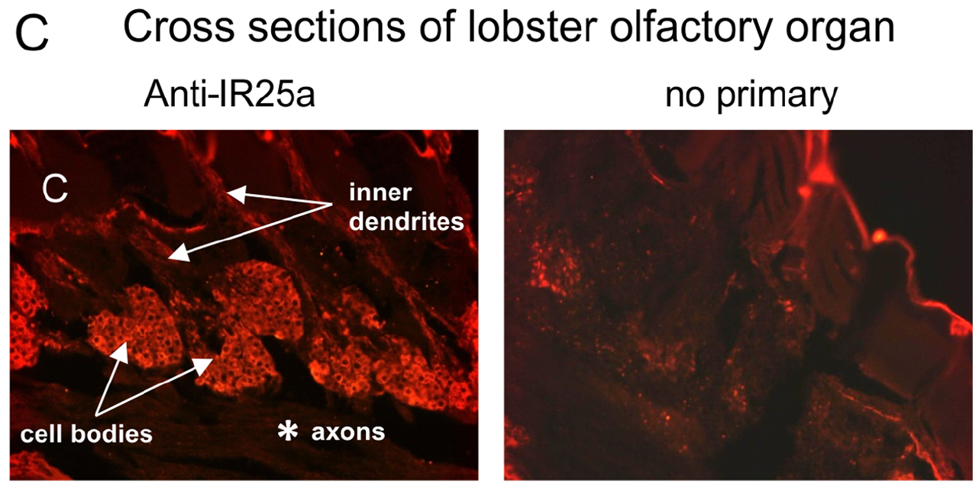
Neighboring sensory cells differ in chemical selectivity
Corey and colleagues loaded clusters of sensory cells with a calcium-sensitive dye and applied different chemical stimuli. Calcium imaging reports changes in intracellular calcium through changing fluorescence, and it can reveal many cells at once, which complements measurements from one neuron at a time. The method therefore shows how a whole cluster responds to a single chemical.
The stimulus set included food extract and, for the amino-acid tests, arginine and glutamate at 1 mM. Neighboring cells showed different response profiles across the stimulus set, so one cell responded to a stimulus that a neighbor ignored. A published heat map summarizes this heterogeneity cell by cell, and it shows that the variation among neighbors is systematic rather than random.
The responses establish chemical selectivity at the cellular level even though the cells share common IR components. Cells that express common IR components therefore differ in which stimuli they detect, and this variation matches the different candidate receptors each cell expresses alongside them. Each cell's stimulus preference is set by its own combination of receptor components.
Corey et al. (2013), Fig. 6A–D. Calcium imaging reveals heterogeneous odor-response profiles.
Corey et al. (2013), Fig. 4C, fluorescent row. IR25a in somata and inner dendrites; control shown.
Corey et al. (2013)
24
Notes:
• Corey and colleagues loaded sensory-cell clusters with a calcium-sensitive dye and applied different chemical stimuli. Calcium imaging reports changes in intracellular calcium through changing fluorescence. It can reveal many cells simultaneously, complementing measurements made from one neuron at a time.
– Deorphanization means identifying the activating ligand of a receptor whose ligand was unknown. Responding to arginine in an intact cell does not prove that any particular expressed receptor is the arginine-binding protein.
• The stimulus set included food extract, arginine and glutamate at 1 mM for the amino-acid tests. Neighboring cells showed different response profiles across the panel. A published heat map summarizes this heterogeneity rather than assigning one shared response to the whole cluster.
• The responses establish chemical selectivity at the cellular level despite broad expression of common IR components. Cells that share common IR components therefore differ in which stimuli they detect, which matches the variable candidates expressed alongside them.
References:
Corey EA, Bobkov Y, Ukhanov K, Ache BW (2013). Ionotropic Crustacean Olfactory Receptors. PLoS ONE 8(4):e60551. https://doi.org/10.1371/journal.pone.0060551
Figure: Corey et al. (2013), Fig. 6A–D. Calcium imaging reveals heterogeneous odor-response profiles.
Figure source: https://doi.org/10.1371/journal.pone.0060551
Figure: Corey et al. (2013), Fig. 4C, fluorescent row. IR25a in somata and inner dendrites; control shown.
Figure source: https://doi.org/10.1371/journal.pone.0060551

Slide 33
Calcium imaging reports activity in many cells at once
Calcium imaging reports changes in intracellular calcium through changing fluorescence of a calcium-sensitive dye. Calcium rises in a neuron when it is excited, so the fluorescence signal tracks activity. Because many cells can be imaged at the same time, the method complements measurements made from one neuron at a time and shows how a population responds to the same stimulus.
Corey and colleagues loaded sensory-cell clusters with the dye and applied food extract and amino acids, with arginine and glutamate tested at 1 mM. Neighboring cells gave different response profiles across that set of stimuli. A published heat map summarizes the heterogeneity cell by cell, so each cell's selectivity is visible on its own row.
Cells that lie side by side and share common IR components can therefore respond to different chemicals. The heat map gives each cell its own response profile, so the cluster is described by many individual profiles rather than by one shared response, and the profiles differ in ways that reflect each cell's receptor complement.
Corey et al. (2013), Fig. 6A–D. Calcium imaging reveals heterogeneous odor-response profiles.
Corey et al. (2013), Fig. 4C, fluorescent row. IR25a in somata and inner dendrites; control shown.
Corey et al. (2013)
24a
Notes:
• Calcium imaging reads out many cells in parallel.
• Method.
– Cells are loaded with a calcium-sensitive dye.
– Fluorescence changes as intracellular calcium changes.
• Advantage.
– Many cells can be monitored at once.
– It complements recordings from one neuron at a time.
• Stimuli.
– The panel included food extract.
– Arginine and glutamate were tested at 1 millimolar.
• Heterogeneity.
– Neighboring cells showed different response profiles.
• Heat map.
– The published heat map gives each cell its own profile across the panel.
• Meaning.
– Cells with common IR components still differ in what they detect.
• Dye loading.
– Clusters of sensory cells were loaded with the dye before stimulation.
• Panel design.
– A panel of different stimuli allows each cell to be given a response profile.
– Cells that respond to the same stimuli have similar profiles.
• Reading fluorescence.
– Brighter fluorescence indicates higher intracellular calcium.
– The change over time after a stimulus defines a response.
– Cells that change for one stimulus and not another are selective.
References:
Corey EA, Bobkov Y, Ukhanov K, Ache BW (2013). Ionotropic Crustacean Olfactory Receptors. PLoS ONE 8(4):e60551. https://doi.org/10.1371/journal.pone.0060551

Slide 34
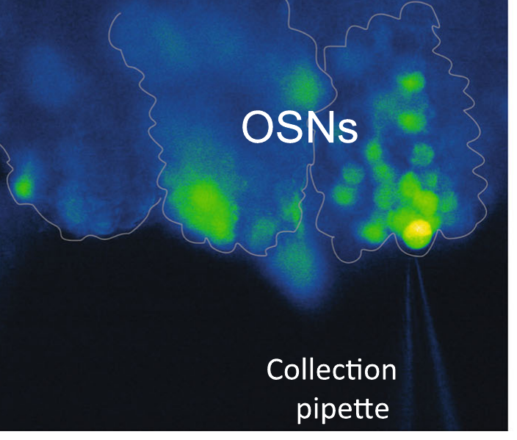
Single-cell sequencing resolves receptor coexpression
Whole-organ sequencing combines RNA from sensory neurons, support cells and other tissue. Kozma and colleagues instead collected individual fluorescently identified olfactory sensory neurons for single-cell transcriptomics, sequencing the expressed RNA of each cell. This separates within-cell coexpression from differences between cell populations.
All seven analyzed single-cell transcriptomes contained IR25a and IR93a. They also contained variable tuning-IR transcripts, while IR8a and IR76b were not detected in those cells. The photographed collection pipette documents the cellular preparation used for sampling.
The result supports shared receptor components with cell-specific combinations of additional candidates. Sequencing each neuron separately places IR25a and IR93a together within single cells, while tuning-IR transcripts differ from cell to cell.
Kozma et al. (2020), Fig. 2d. Sensory-cell cluster and collection pipette.
Kozma et al. (2020)
25
Notes:
• Whole-organ sequencing combines RNA from sensory neurons, support cells and other tissue. Kozma and colleagues instead collected individual fluorescently identified olfactory sensory neurons for single-cell transcriptomics, sequencing the expressed RNA of each cell. This separates within-cell coexpression from differences between cell populations.
– A transcriptome is the set of RNA molecules detected in a sample. Sequencing depth and amplification affect which low-abundance transcripts are recovered, especially when the starting material is one cell.
• All seven analyzed single-cell transcriptomes contained IR25a and IR93a. They also contained variable tuning-IR transcripts, while IR8a and IR76b were not detected in those cells. The photographed collection pipette documents the cellular preparation used for sampling.
• The result supports shared receptor components with cell-specific combinations of additional candidates. Sequencing each neuron separately places IR25a and IR93a together within single cells, while tuning-IR transcripts differ from cell to cell.
References:
Kozma MT, Ngo-Vu H, Rump MT, Bobkov YV, Ache BW, Derby CD (2020). Single cell transcriptomes reveal expression patterns of chemoreceptor genes in olfactory sensory neurons of the Caribbean spiny lobster, Panulirus argus. BMC Genomics 21(1):649. https://doi.org/10.1186/s12864-020-07034-7
Figure: Kozma et al. (2020), Fig. 2d. Sensory-cell cluster and collection pipette.
Figure source: https://doi.org/10.1186/s12864-020-07034-7

Slide 35
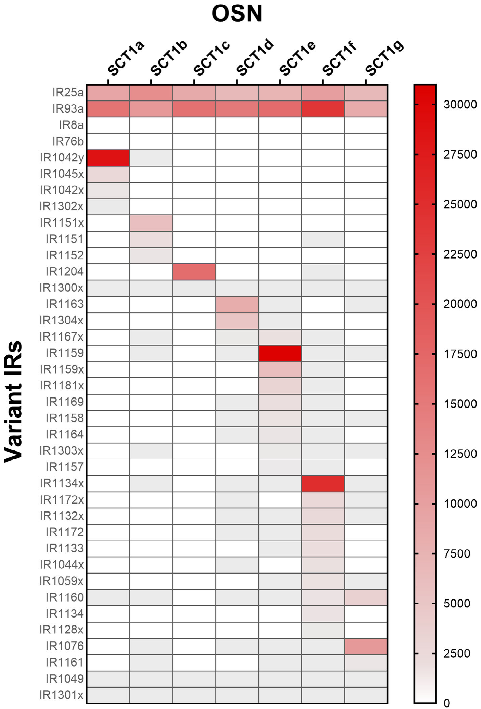
A neuron can express many candidate tuning receptors
Tuning IRs are variable receptor candidates proposed to contribute ligand selectivity alongside more widely expressed components. Kozma and colleagues compared their abundance across single olfactory sensory neurons. The original heat map displays receptor identity by row and cellular sample by column.
Each analyzed neuron contained 9–53 tuning-IR transcripts, often with only one or a few expressed at high abundance. This arrangement differs from a simple rule in which every sensory neuron expresses exactly one ligand-selective receptor. Shared coreceptors do not eliminate molecular diversity between cells.
Each neuron carries its own combination of tuning-IR transcripts, so receptor diversity arises from which candidates a cell expresses at high abundance on top of shared coreceptors.
Kozma et al. (2020), Fig. 2d. Sensory-cell cluster and collection pipette.
Kozma et al. (2020), Fig. 3. Single-cell expression of common and variable ionotropic receptors.
Kozma et al. (2020)
26
Notes:
• Tuning IRs are variable receptor candidates proposed to contribute ligand selectivity alongside more widely expressed components. Kozma and colleagues compared their abundance across single olfactory sensory neurons. The original heat map displays receptor identity by row and cellular sample by column.
– A heat-map color is a transformed expression measurement from the original paper. A stronger color does not establish a proportionally larger odor-evoked current because translation and channel regulation intervene.
• Each analyzed neuron contained 9–53 tuning-IR transcripts, often with only one or a few expressed at high abundance. This arrangement differs from a simple rule in which every sensory neuron expresses exactly one ligand-selective receptor. Shared coreceptors do not eliminate molecular diversity between cells.
• Each neuron carries its own combination of tuning-IR transcripts, so receptor diversity arises from which candidates a cell expresses at high abundance on top of shared coreceptors.
References:
Kozma MT, Ngo-Vu H, Rump MT, Bobkov YV, Ache BW, Derby CD (2020). Single cell transcriptomes reveal expression patterns of chemoreceptor genes in olfactory sensory neurons of the Caribbean spiny lobster, Panulirus argus. BMC Genomics 21(1):649. https://doi.org/10.1186/s12864-020-07034-7
Figure: Kozma et al. (2020), Fig. 3. Single-cell expression of common and variable ionotropic receptors.
Figure source: https://doi.org/10.1186/s12864-020-07034-7
Figure: Kozma et al. (2020), Fig. 2d. Sensory-cell cluster and collection pipette.
Figure source: https://doi.org/10.1186/s12864-020-07034-7

Slide 36
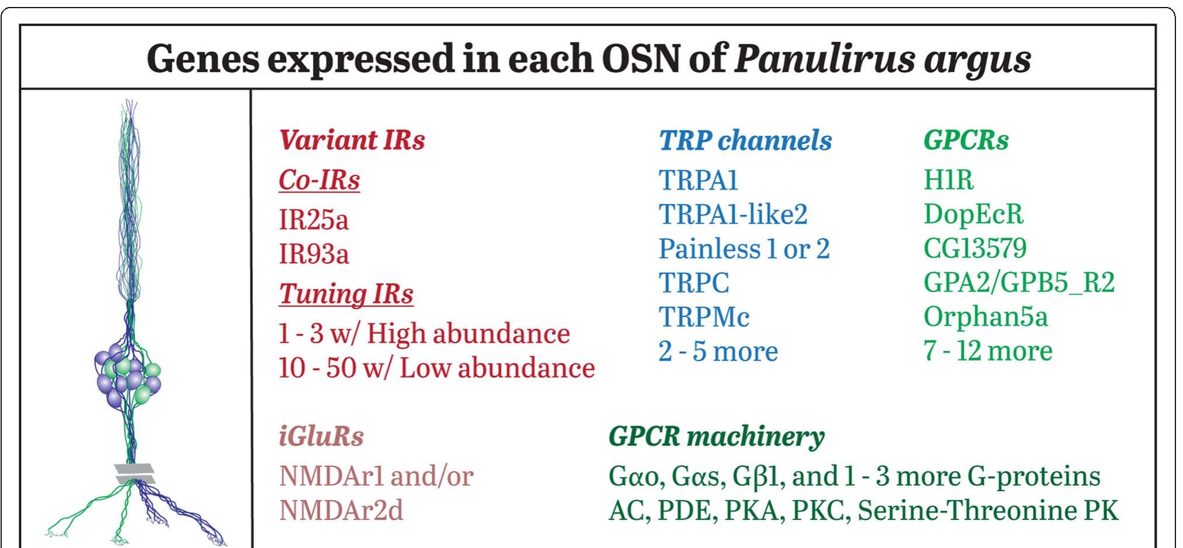
Gene expression does not establish odor recognition
Kozma and colleagues also examined G-protein-coupled receptors, or GPCRs, and transient receptor potential channels, or TRP channels, in sensory neurons. GPCRs can regulate intracellular signaling, whereas TRP proteins form ion channels with diverse sensory and cellular functions.
Individual cells expressed 12–17 GPCR candidates and overlapping sets of TRP-channel genes. The published summary includes common proteins and additional variable candidates. These transcript inventories reveal potential molecular machinery alongside the IR family rather than one fully resolved odor-transduction pathway.
A GPCR in an olfactory neuron may bind an odor or receive modulatory input, and a TRP channel may shape the response without carrying the primary receptor current. Transcript inventories nominate candidate signaling components that ligand responses and perturbations in identified cells can test.
Kozma et al. (2020), Fig. 4. Authors’ summary of genes expressed in olfactory sensory neurons.
Kozma et al. (2020), Fig. 2d. Sensory-cell cluster and collection pipette.
Kozma et al. (2020)
27
Notes:
• Kozma and colleagues also examined G-protein-coupled receptors, or GPCRs, and transient receptor potential channels, or TRP channels, in sensory neurons. GPCRs can regulate intracellular signaling, whereas TRP proteins form ion channels with diverse sensory and cellular functions.
– A G protein links some activated receptors to intracellular enzymes or channels. Molecular presence indicates that a pathway could exist, but causal function must be tested rather than assigned from a protein-family name.
• Individual cells expressed 12–17 GPCR candidates and overlapping sets of TRP-channel genes. The published summary includes common proteins and additional variable candidates. These transcript inventories reveal potential molecular machinery alongside the IR family rather than one fully resolved odor-transduction pathway.
• A GPCR in an olfactory neuron may bind an odor or receive modulatory input, and a TRP channel may shape the response without carrying the primary receptor current. Transcript inventories nominate candidate signaling components that ligand responses and perturbations in identified cells can test.
References:
Kozma MT, Ngo-Vu H, Rump MT, Bobkov YV, Ache BW, Derby CD (2020). Single cell transcriptomes reveal expression patterns of chemoreceptor genes in olfactory sensory neurons of the Caribbean spiny lobster, Panulirus argus. BMC Genomics 21(1):649. https://doi.org/10.1186/s12864-020-07034-7
Figure: Kozma et al. (2020), Fig. 4. Authors’ summary of genes expressed in olfactory sensory neurons.
Figure source: https://doi.org/10.1186/s12864-020-07034-7
Figure: Kozma et al. (2020), Fig. 2d. Sensory-cell cluster and collection pipette.
Figure source: https://doi.org/10.1186/s12864-020-07034-7

Slide 37
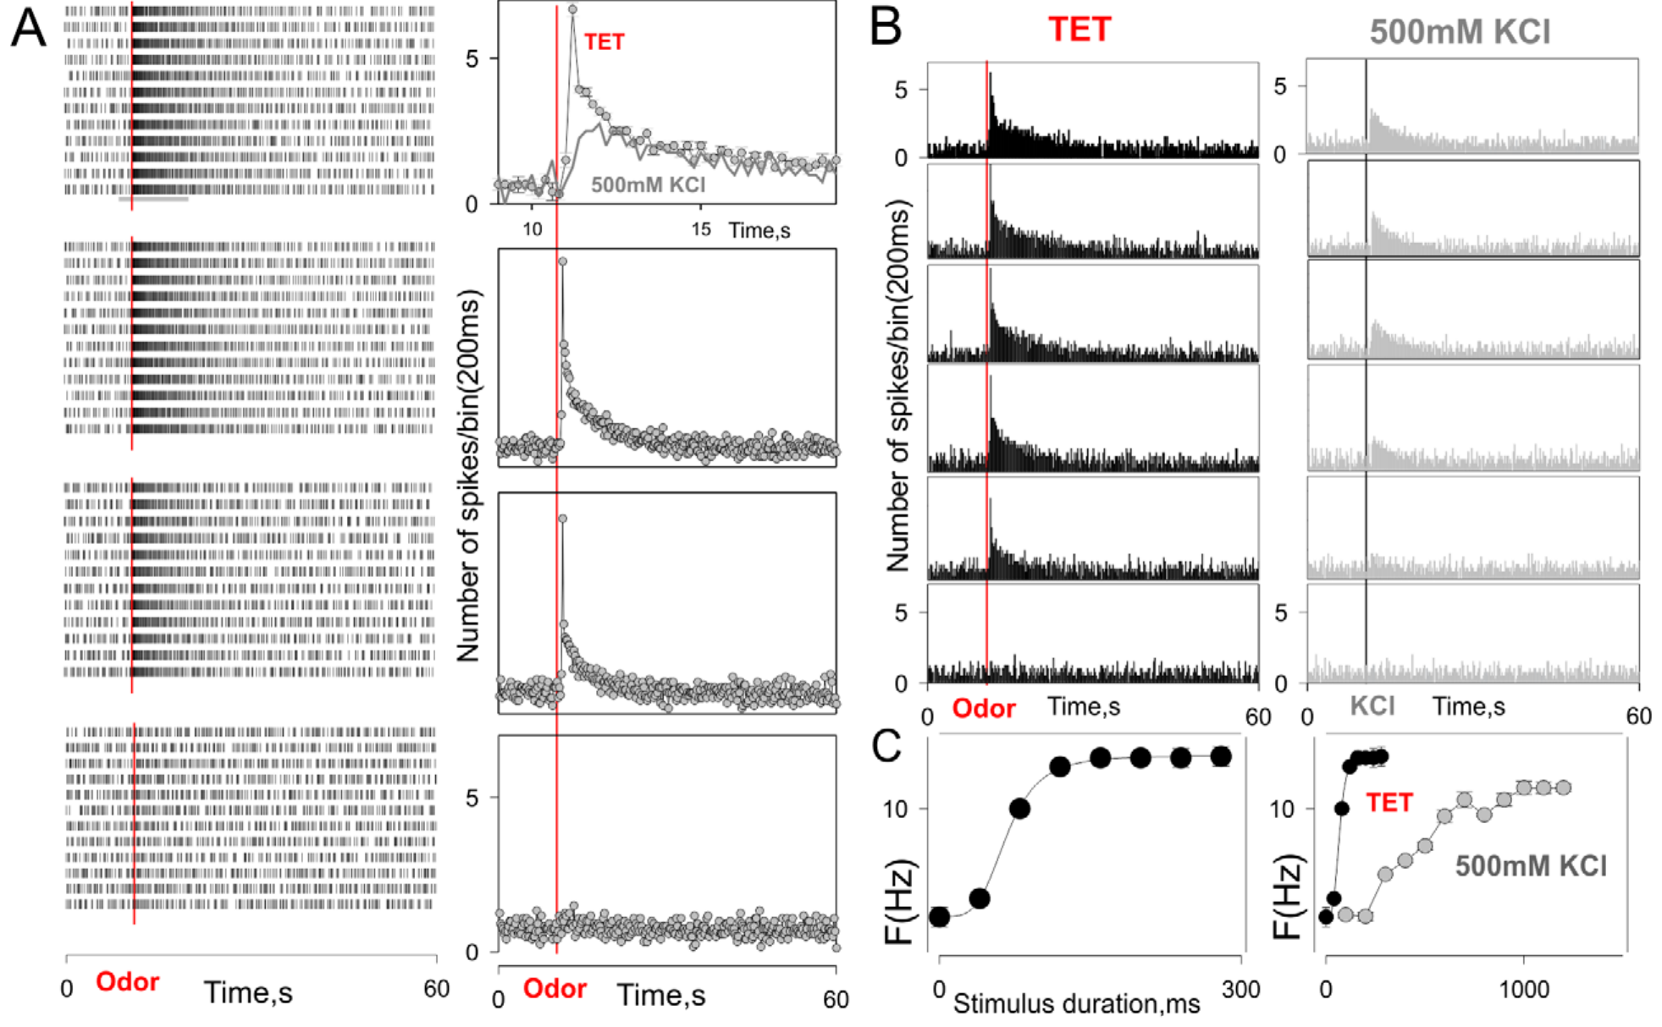
Controlled odor delivery separates input from response
Bobkov and colleagues recorded Panulirus sensory neurons in a semi-intact antennular preparation. Odor reached the outer dendrites while the cell bodies remained accessible to electrodes and imaging. Separate fluid compartments limited direct stimulation of somata and allowed repeated inputs to the sensory surface.
A fluorescent tracer characterized stimulus timing, while calcium imaging and loose-patch recordings measured responses. Food extract was tested at concentrations up to 0.5 mg/mL. Increasing pulse duration increased the effective delivered stimulus, but did not create a perfectly independent change in concentration alone.
These calibrations establish when chemical input arrived relative to cellular activity. Pulse duration, onset kinetics and effective dose can covary, so responses are interpreted against the measured delivery waveform and not only the source solution.
Bobkov et al. (2012), Fig. 1A–C. Simultaneous dye calibration, calcium responses and firing-rate controls.
Corey et al. (2013), Fig. 4C, fluorescent row. IR25a in somata and inner dendrites; control shown.
Bobkov et al. (2012); Corey et al. (2013)
28
Notes:
• Bobkov and colleagues recorded Panulirus sensory neurons in a semi-intact antennular preparation. Odor reached the outer dendrites while the cell bodies remained accessible to electrodes and imaging. Separate fluid compartments limited direct stimulation of somata and allowed repeated inputs to the sensory surface.
– A loose-patch electrode detects spikes without tightly controlling membrane voltage. It records output timing, while stimulus calibration independently measures the physical input that produces that output.
• A fluorescent tracer characterized stimulus timing, while calcium imaging and loose-patch recordings measured responses. Food extract was tested at concentrations up to 0.5 mg/mL. Increasing pulse duration increased the effective delivered stimulus, but did not create a perfectly independent change in concentration alone.
• These calibrations establish when chemical input arrived relative to cellular activity. Pulse duration, onset kinetics and effective dose can covary, so responses are interpreted against the measured delivery waveform and not only the source solution.
References:
Bobkov Y, Park I, Ukhanov K, Principe J, Ache B (2012). Cellular Basis for Response Diversity in the Olfactory Periphery. PLoS ONE 7(4):e34843. https://doi.org/10.1371/journal.pone.0034843
Corey EA, Bobkov Y, Ukhanov K, Ache BW (2013). Ionotropic Crustacean Olfactory Receptors. PLoS ONE 8(4):e60551. https://doi.org/10.1371/journal.pone.0060551
Figure: Bobkov et al. (2012), Fig. 1A–C. Simultaneous dye calibration, calcium responses and firing-rate controls.
Figure source: https://doi.org/10.1371/journal.pone.0034843
Figure: Corey et al. (2013), Fig. 4C, fluorescent row. IR25a in somata and inner dendrites; control shown.
Figure source: https://doi.org/10.1371/journal.pone.0060551

Slide 38
Whole-cell recording measures currents in one neuron
Whole-cell recording gains electrical access to a neuron through a glass pipette, so membrane voltage or current can be measured directly. In voltage clamp the experimenter holds the membrane at a fixed voltage and measures the current that flows.
Bobkov and colleagues recorded Panulirus sensory neurons in a semi-intact antennular preparation in which odor reached the outer dendrites and the somata stayed accessible. Loose-patch recordings monitored spikes, and voltage-clamp recordings near −70 to −60 mV measured inward or outward odor-evoked currents.
Combined with a fluorescent tracer that characterized stimulus timing, the recordings relate cellular responses to the moment that odor arrived. Currents show the direction of the response in each cell, which separates excitation from inhibition at the periphery.
Bobkov et al. (2012), Fig. 1A–C. Simultaneous dye calibration, calcium responses and firing-rate controls.
Corey et al. (2013), Fig. 4C, fluorescent row. IR25a in somata and inner dendrites; control shown.
Bobkov et al. (2012); Corey et al. (2013)
28a
Notes:
• Patch recording gives direct access to the electrical response of a receptor neuron.
• Whole-cell recording.
– A glass pipette gains electrical access to the neuron.
– Membrane voltage or current is measured directly.
• Voltage clamp.
– The membrane is held at a fixed voltage.
– The current that flows is the measured quantity.
• Loose patch.
– Loose-patch recordings monitored spikes.
• Preparation.
– A semi-intact antennular preparation exposed the outer dendrites to odor.
– The cell bodies stayed accessible to electrodes.
• Holding voltage.
– Recordings were made near minus 70 to minus 60 millivolts.
• Meaning.
– Current direction separates excitation from inhibition, and a tracer shows when the odor arrived.
• Separate compartments.
– Separate fluid compartments limited direct stimulation of the somata.
– Odor reached the sensory surface and electrodes reached the cell bodies.
• Stimulus.
– Food extract was tested at concentrations up to 0.5 milligrams per milliliter.
– A fluorescent tracer characterized the timing of delivery.
• Why delivery matters.
– Increasing pulse duration increased the effective delivered stimulus.
– Concentration and duration therefore affect the response together.
– The measured delivery waveform is the correct description of the stimulus.
References:
Bobkov Y, Park I, Ukhanov K, Principe J, Ache B (2012). Cellular Basis for Response Diversity in the Olfactory Periphery. PLoS ONE 7(4):e34843. https://doi.org/10.1371/journal.pone.0034843
Corey EA, Bobkov Y, Ukhanov K, Ache BW (2013). Ionotropic Crustacean Olfactory Receptors. PLoS ONE 8(4):e60551. https://doi.org/10.1371/journal.pone.0060551

Slide 39
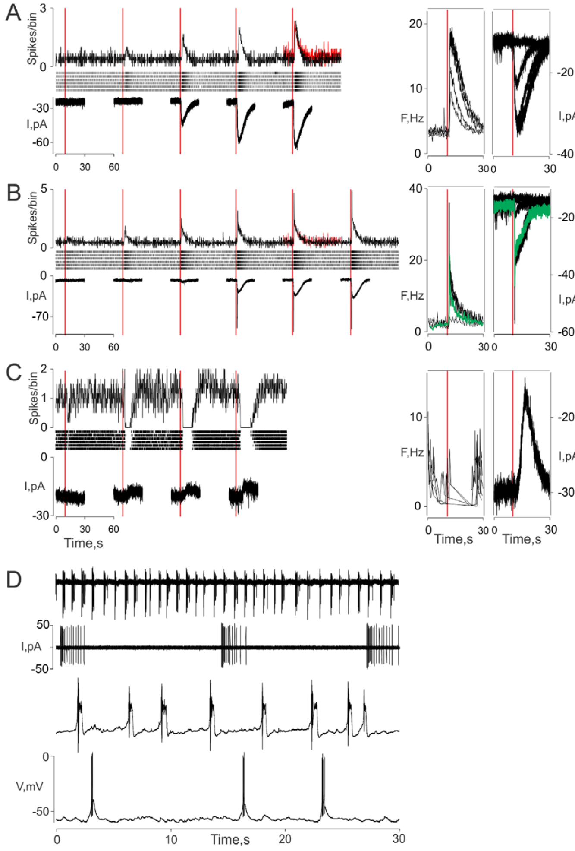
Peripheral neurons can be excited or inhibited by odor
Bobkov and colleagues found tonic excitation, phasic–tonic excitation and inhibition among olfactory receptor neurons exposed to food extract. Tonic responses persist during stimulation; phasic responses emphasize its beginning. Inhibitory responses reduce activity relative to the cell’s unstimulated state.
Whole-cell voltage-clamp recordings near −70 to −60 mV measured inward or outward odor-evoked currents alongside firing patterns. Excitatory current could persist or adapt rapidly, while some cells showed inhibitory currents. Thus, diversity was already present in the receptor input, before central synaptic processing.
The observations reject an account in which all peripheral cells transmit the same excitation and the brain creates every inhibitory response. Excitatory and inhibitory currents both arise in receptor neurons, and the direction of a current depends on the holding voltage and the ionic driving force.
Corey et al. (2013), Fig. 4C, fluorescent row. IR25a in somata and inner dendrites; control shown.
Bobkov et al. (2012), Fig. 2A–D. Excitatory, inhibitory and intrinsic sensory activity.
Bobkov et al. (2012); Corey et al. (2013)
29
Notes:
• Bobkov and colleagues found tonic excitation, phasic–tonic excitation and inhibition among olfactory receptor neurons exposed to food extract. Tonic responses persist during stimulation; phasic responses emphasize its beginning. Inhibitory responses reduce activity relative to the cell’s unstimulated state.
– Voltage clamp holds membrane voltage near a chosen level and measures compensating current. A current trace therefore reveals membrane conductance changes more directly than a spike train, but requires ionic tests to identify the ions involved.
• Whole-cell voltage-clamp recordings near −70 to −60 mV measured inward or outward odor-evoked currents alongside firing patterns. Excitatory current could persist or adapt rapidly, while some cells showed inhibitory currents. Thus, diversity was already present in the receptor input, before central synaptic processing.
• The observations reject an account in which all peripheral cells transmit the same excitation and the brain creates every inhibitory response. Excitatory and inhibitory currents both arise in receptor neurons, and the direction of a current depends on the holding voltage and the ionic driving force.
References:
Bobkov Y, Park I, Ukhanov K, Principe J, Ache B (2012). Cellular Basis for Response Diversity in the Olfactory Periphery. PLoS ONE 7(4):e34843. https://doi.org/10.1371/journal.pone.0034843
Corey EA, Bobkov Y, Ukhanov K, Ache BW (2013). Ionotropic Crustacean Olfactory Receptors. PLoS ONE 8(4):e60551. https://doi.org/10.1371/journal.pone.0060551
Figure: Bobkov et al. (2012), Fig. 2A–D. Excitatory, inhibitory and intrinsic sensory activity.
Figure source: https://doi.org/10.1371/journal.pone.0034843
Figure: Corey et al. (2013), Fig. 4C, fluorescent row. IR25a in somata and inner dendrites; control shown.
Figure source: https://doi.org/10.1371/journal.pone.0060551

Slide 40
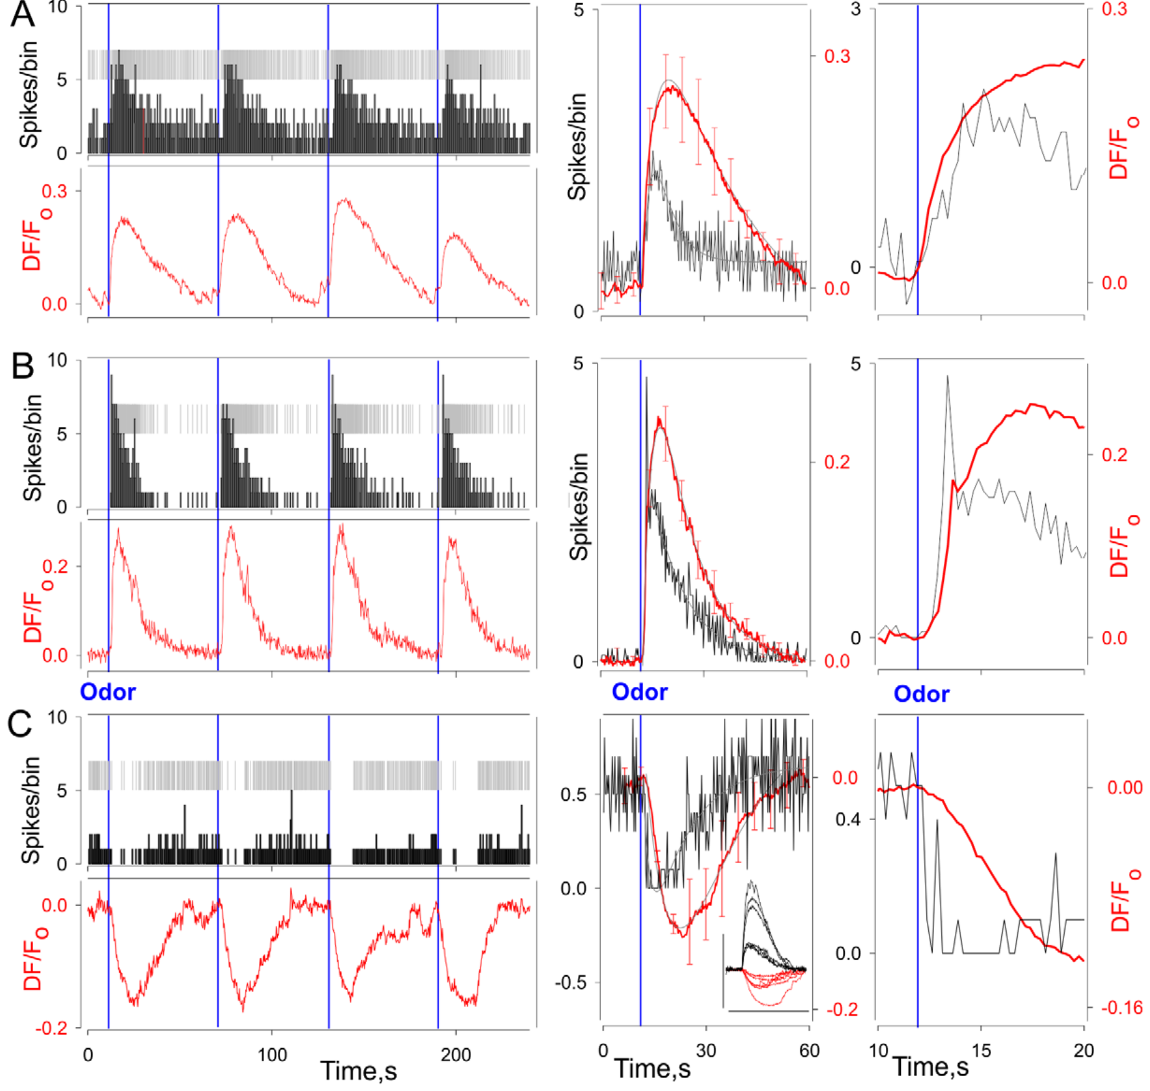
Calcium signals and spikes have different time courses
Calcium-sensitive fluorescence is often used as a proxy for neuronal activity, but it is not an action potential. Bobkov and colleagues recorded spikes and calcium simultaneously in identified lobster sensory neurons. The comparison tested how reliably a slower optical signal represents rapid electrical output.
Tonic, phasic–tonic and inhibitory neurons showed corresponding but differently filtered fluorescence changes. Calcium generally changed more slowly than the spike pattern. An inhibitory optical response could accompany reduced firing, while excitation increased firing and then accumulated a calcium signal.
Calcium imaging identifies tonic, phasic–tonic and inhibitory response classes. The fluorescence is slower than the spikes because dye kinetics, intracellular buffering and calcium removal intervene between them.
Bobkov et al. (2012), Fig. 3A–C. Simultaneous spikes and calcium responses across neuronal response classes.
Corey et al. (2013), Fig. 4C, fluorescent row. IR25a in somata and inner dendrites; control shown.
Bobkov et al. (2012); Corey et al. (2013)
30
Notes:
• Calcium-sensitive fluorescence is often used as a proxy for neuronal activity, but it is not an action potential. Bobkov and colleagues recorded spikes and calcium simultaneously in identified lobster sensory neurons. The comparison tested how reliably a slower optical signal represents rapid electrical output.
– Calcium can enter through voltage-dependent channels and can also be released from intracellular stores. This simultaneous-recording experiment relates fluorescence to activity without proving the contribution of each calcium source.
• Tonic, phasic–tonic and inhibitory neurons showed corresponding but differently filtered fluorescence changes. Calcium generally changed more slowly than the spike pattern. An inhibitory optical response could accompany reduced firing, while excitation increased firing and then accumulated a calcium signal.
• Calcium imaging identifies tonic, phasic–tonic and inhibitory response classes. The fluorescence is slower than the spikes because dye kinetics, intracellular buffering and calcium removal intervene between them.
References:
Bobkov Y, Park I, Ukhanov K, Principe J, Ache B (2012). Cellular Basis for Response Diversity in the Olfactory Periphery. PLoS ONE 7(4):e34843. https://doi.org/10.1371/journal.pone.0034843
Corey EA, Bobkov Y, Ukhanov K, Ache BW (2013). Ionotropic Crustacean Olfactory Receptors. PLoS ONE 8(4):e60551. https://doi.org/10.1371/journal.pone.0060551
Figure: Bobkov et al. (2012), Fig. 3A–C. Simultaneous spikes and calcium responses across neuronal response classes.
Figure source: https://doi.org/10.1371/journal.pone.0034843
Figure: Corey et al. (2013), Fig. 4C, fluorescent row. IR25a in somata and inner dendrites; control shown.
Figure source: https://doi.org/10.1371/journal.pone.0060551

Slide 41
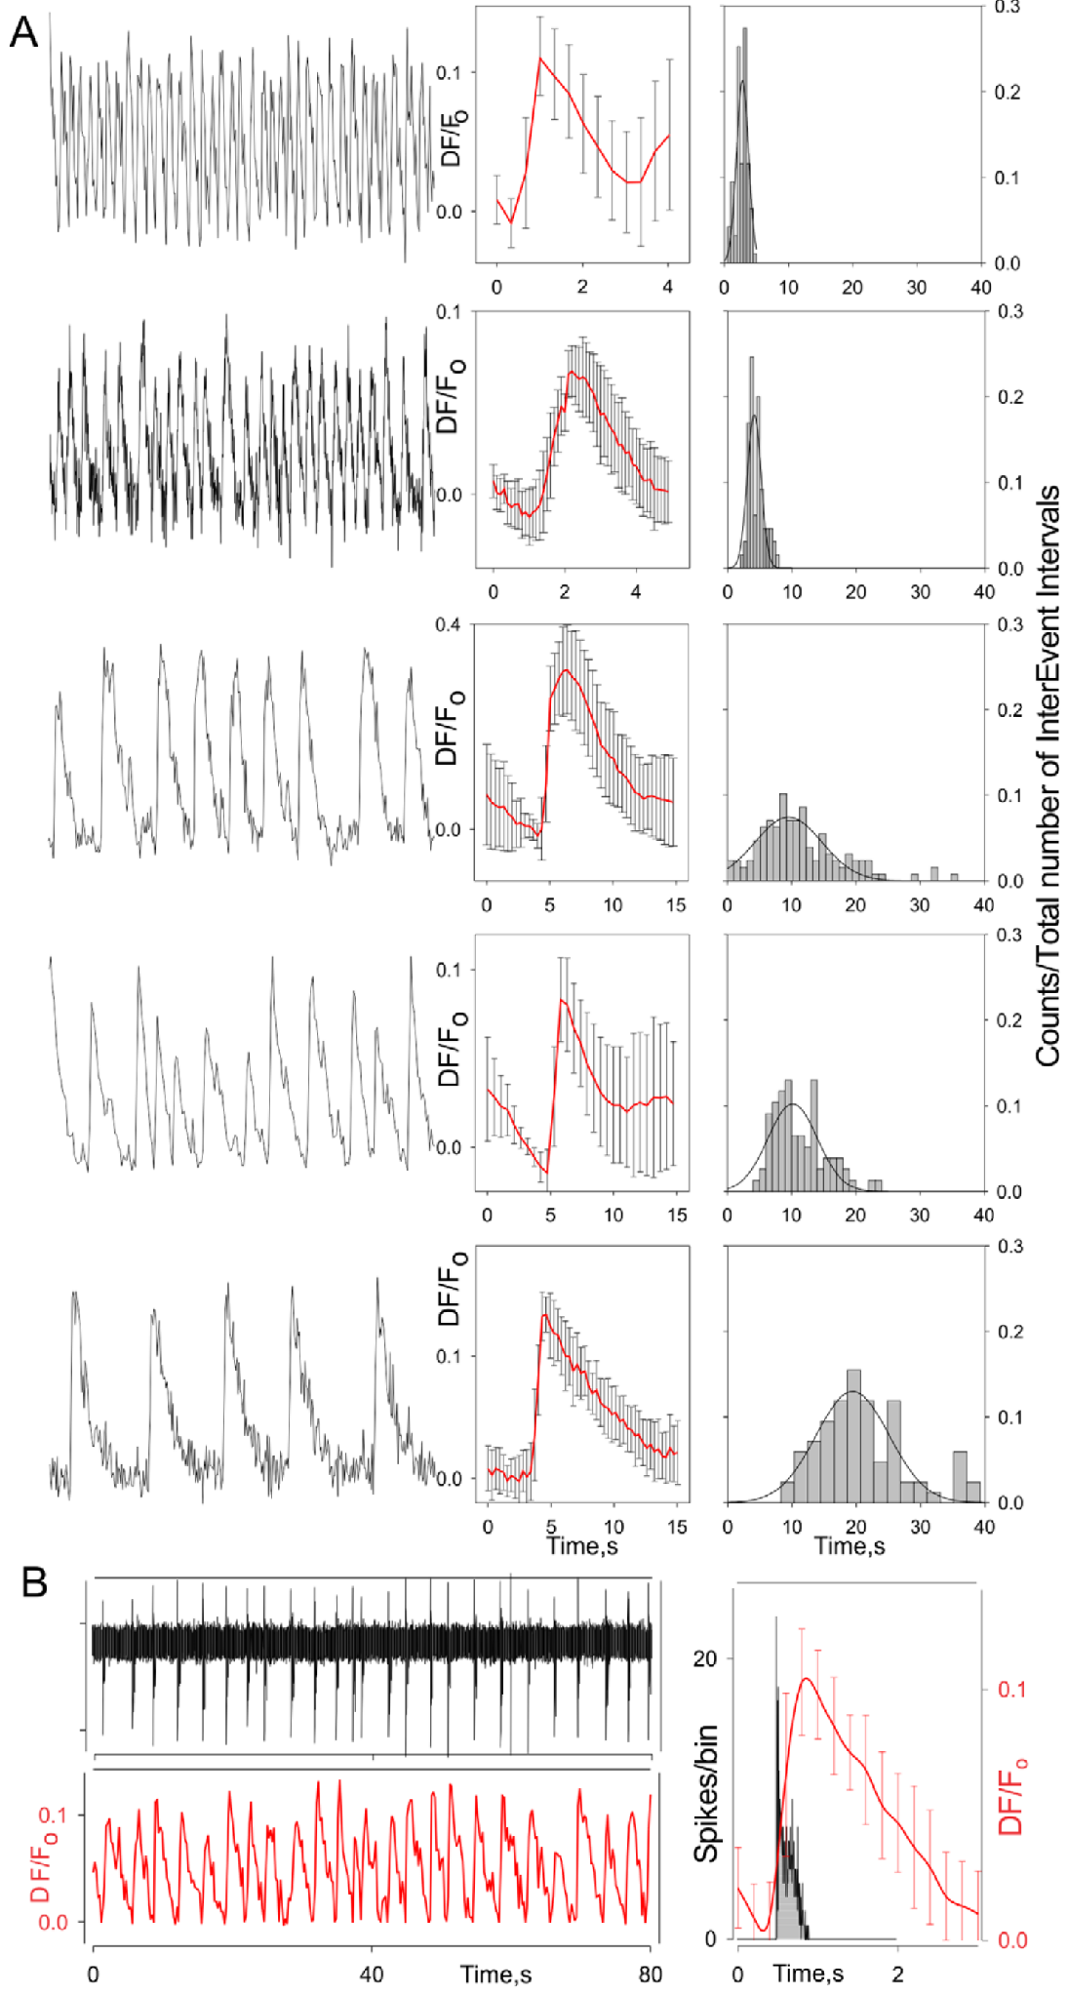
Some olfactory neurons burst without odor stimulation
A burst is a cluster of spikes separated from another cluster by a quieter interval. Bobkov and colleagues observed intrinsically bursting olfactory receptor neurons in the absence of presented odor. Their spontaneous output therefore contains temporal structure before environmental stimulation is added.
Simultaneous recordings showed repeated electrical bursts followed by slower calcium oscillations. Across cells, optical oscillation frequencies ranged from approximately 0.015 to 0.9 Hz, with an average near 0.16 Hz. Different cells consequently supplied different intrinsic temporal reference scales.
Spontaneous bursting gives each cell its own temporal structure, so an odor-evoked burst must be distinguished from a spontaneous burst when a cell signals a new encounter.
Corey et al. (2013), Fig. 4C, fluorescent row. IR25a in somata and inner dendrites; control shown.
Bobkov et al. (2012), Fig. 4A–B. Simultaneous bursting and slower calcium oscillations.
Bobkov et al. (2012); Corey et al. (2013)
31
Notes:
• A burst is a cluster of spikes separated from another cluster by a quieter interval. Bobkov and colleagues observed intrinsically bursting olfactory receptor neurons in the absence of presented odor. Their spontaneous output therefore contains temporal structure before environmental stimulation is added.
– Intrinsic means generated by the neuron’s own dynamics under the recording conditions. It does not mean the neuron is unaffected by chemical stimulation, modulators or the ionic composition of the preparation.
• Simultaneous recordings showed repeated electrical bursts followed by slower calcium oscillations. Across cells, optical oscillation frequencies ranged from approximately 0.015 to 0.9 Hz, with an average near 0.16 Hz. Different cells consequently supplied different intrinsic temporal reference scales.
• Spontaneous bursting gives each cell its own temporal structure, so an odor-evoked burst must be distinguished from a spontaneous burst when a cell signals a new encounter.
References:
Bobkov Y, Park I, Ukhanov K, Principe J, Ache B (2012). Cellular Basis for Response Diversity in the Olfactory Periphery. PLoS ONE 7(4):e34843. https://doi.org/10.1371/journal.pone.0034843
Corey EA, Bobkov Y, Ukhanov K, Ache BW (2013). Ionotropic Crustacean Olfactory Receptors. PLoS ONE 8(4):e60551. https://doi.org/10.1371/journal.pone.0060551
Figure: Bobkov et al. (2012), Fig. 4A–B. Simultaneous bursting and slower calcium oscillations.
Figure source: https://doi.org/10.1371/journal.pone.0034843
Figure: Corey et al. (2013), Fig. 4C, fluorescent row. IR25a in somata and inner dendrites; control shown.
Figure source: https://doi.org/10.1371/journal.pone.0060551

Slide 42
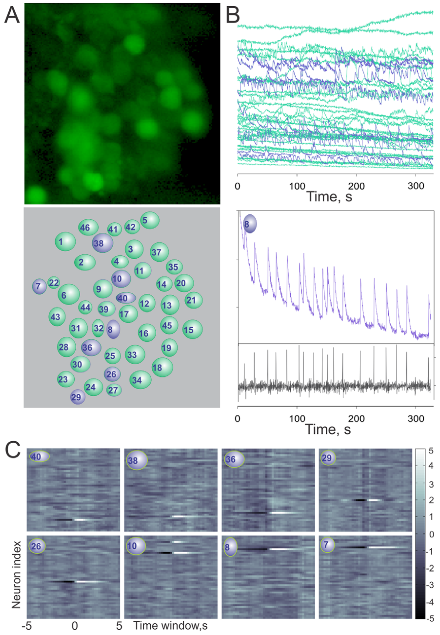
Adjacent receptor neurons need not share an oscillator
Bobkov and colleagues imaged many sensory somata within the same antennular cluster and compared their calcium time series. Correlation measures the degree to which two signals vary together. Pairwise comparisons tested whether nearby bursting cells behaved as one tightly synchronized peripheral network, which would produce a shared rhythm across the cluster.
Most recorded pairs were weakly correlated and showed different oscillatory timing, so neighboring cells generally followed separate rhythms. A small number of highly similar records were checked for overlapping optical sampling before cellular coupling was inferred, so the synchronized pairs were assessed for their origin, and only the pairs that survived that check were treated as coupled.
Weak correlation among most pairs indicates that nearby sensory cells oscillate largely independently, so each cell contributes its own timing to the peripheral population. The population signal is therefore the sum of many separate rhythms, and the independence of those rhythms keeps the cluster's output rich in timing information. Separate oscillators therefore add variety to the peripheral signal rather than repeating a single rhythm.
Bobkov et al. (2012), Fig. 5A–C. Colored sensory-cell images, calcium records and pairwise correlations.
Bobkov et al. (2012)
32
Notes:
• Bobkov and colleagues imaged many sensory somata within the same antennular cluster and compared their calcium time series. Correlation measures the degree to which two signals vary together. Pairwise comparisons tested whether nearby bursting cells behaved as one tightly synchronized peripheral network.
– Independent oscillators can provide diverse temporal sensitivities. A population may become more informative by combining their outputs centrally even when neighboring peripheral cells do not synchronize with one another.
• Most recorded pairs were weakly correlated and exhibited different oscillatory timing. A small number of highly similar records could arise from overlapping optical sampling, which required caution before attributing them to cellular coupling. The colored micrograph identifies the individual regions used for analysis.
• Weak correlation among most pairs indicates that nearby sensory cells oscillate largely independently, so each cell contributes its own timing to the peripheral population.
References:
Bobkov Y, Park I, Ukhanov K, Principe J, Ache B (2012). Cellular Basis for Response Diversity in the Olfactory Periphery. PLoS ONE 7(4):e34843. https://doi.org/10.1371/journal.pone.0034843
Figure: Bobkov et al. (2012), Fig. 5A–C. Colored sensory-cell images, calcium records and pairwise correlations.
Figure source: https://doi.org/10.1371/journal.pone.0034843

Slide 43
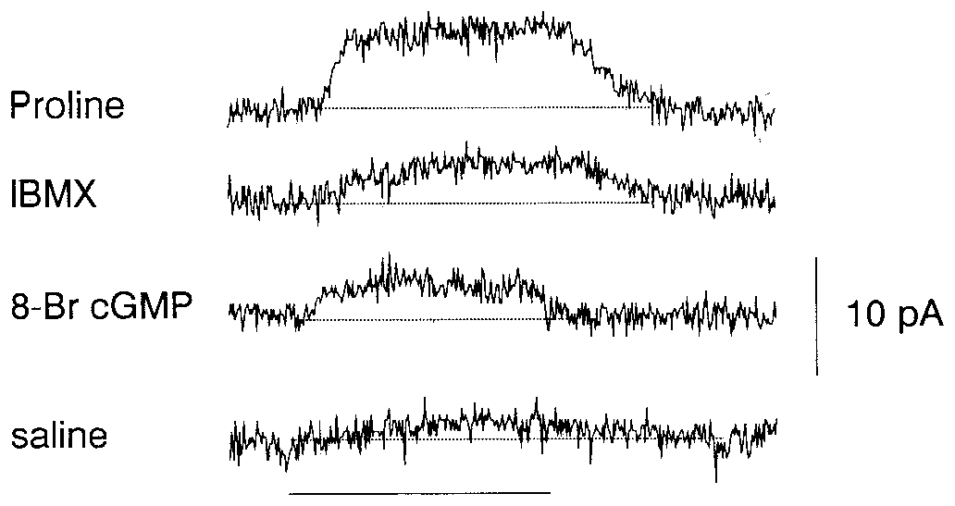
Cyclic nucleotides can support peripheral inhibition
A second messenger is an intracellular molecule whose concentration changes after signaling begins. Michel and Ache tested cyclic nucleotides in lobster sensory neurons that were excited by food extract but inhibited by proline. Whole-cell recordings were made at a holding voltage of −60 mV.
Proline produced a small outward current in this cell class. The phosphodiesterase inhibitor IBMX at 1 mM and membrane-permeant cyclic-nucleotide analogs could mimic an outward response. These manipulations link intracellular cyclic-nucleotide accumulation to a conductance associated with peripheral inhibition.
The interpretation builds on an odor-evoked potassium conductance characterized in this receptor-cell system. Raising cyclic-nucleotide levels with IBMX or analogs reproduces the outward current, which places cyclic nucleotides in the inhibitory transduction pathway.
Michel & Ache (1992), Fig. 4. Proline, phosphodiesterase inhibition and cyclic-GMP analog evoke outward currents.
Corey et al. (2013), Fig. 4C, fluorescent row. IR25a in somata and inner dendrites; control shown.
Michel & Ache (1992); Corey et al. (2013)
33
Notes:
• A second messenger is an intracellular molecule whose concentration changes after signaling begins. Michel and Ache tested cyclic nucleotides in lobster sensory neurons that were excited by food extract but inhibited by proline. Whole-cell recordings were made at a holding voltage of −60 mV.
– A phosphodiesterase normally breaks down cyclic nucleotides. Blocking it can raise intracellular signaling levels, but its inhibitor is a pathway probe rather than an odor-specific receptor ligand.
• Proline produced a small outward current in this cell class. The phosphodiesterase inhibitor IBMX at 1 mM and membrane-permeant cyclic-nucleotide analogs could mimic an outward response. These manipulations link intracellular cyclic-nucleotide accumulation to a conductance associated with peripheral inhibition.
• The interpretation builds on an odor-evoked potassium conductance characterized in this receptor-cell system. Raising cyclic-nucleotide levels with IBMX or analogs reproduces the outward current, which places cyclic nucleotides in the inhibitory transduction pathway.
References:
Michel WC, Ache BW (1992). Cyclic nucleotides mediate an odor-evoked potassium conductance in lobster olfactory receptor cells. The Journal of Neuroscience 12(10):3979-3984. https://doi.org/10.1523/jneurosci.12-10-03979.1992
Corey EA, Bobkov Y, Ukhanov K, Ache BW (2013). Ionotropic Crustacean Olfactory Receptors. PLoS ONE 8(4):e60551. https://doi.org/10.1371/journal.pone.0060551
Figure: Michel & Ache (1992), Fig. 4. Proline, phosphodiesterase inhibition and cyclic-GMP analog evoke outward currents.
Figure source: https://doi.org/10.1523/jneurosci.12-10-03979.1992
Figure: Corey et al. (2013), Fig. 4C, fluorescent row. IR25a in somata and inner dendrites; control shown.
Figure source: https://doi.org/10.1371/journal.pone.0060551

Slide 44
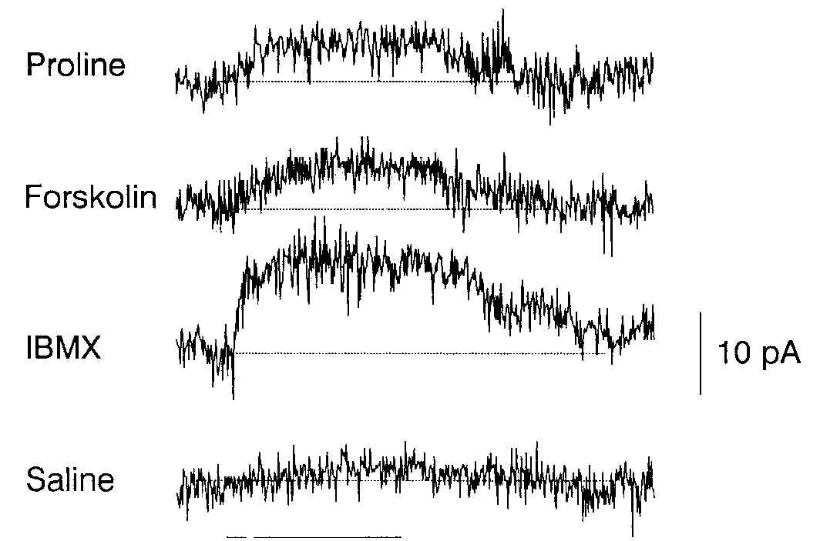
Enzyme activation probes a candidate inhibitory pathway
Adenylyl cyclase synthesizes cyclic AMP, or cAMP. Michel and Ache applied forskolin, an activator of this enzyme, to test whether increasing its activity could reproduce proline-associated inhibition. Saline application provided a comparison for the mechanical delivery of solution.
Forskolin at 50 µM evoked an outward current in proline-inhibited neurons, and IBMX enhanced related responses by reducing nucleotide breakdown. Cells excited by food extract but not inhibited by proline supplied a contrasting response class, helping separate a general toxic effect from pathway-dependent sensitivity.
The results support cyclic-nucleotide participation in inhibitory transduction. Forskolin raises cAMP by activating adenylyl cyclase, and the outward current it evokes in proline-inhibited cells fits cAMP acting as a second messenger in the inhibitory pathway.
Michel & Ache (1992), Fig. 2. Forskolin and IBMX evoke an outward current in a proline-inhibited neuron.
Corey et al. (2013), Fig. 4C, fluorescent row. IR25a in somata and inner dendrites; control shown.
Michel & Ache (1992); Corey et al. (2013)
34
Notes:
• Adenylyl cyclase synthesizes cyclic AMP, or cAMP. Michel and Ache applied forskolin, an activator of this enzyme, to test whether increasing its activity could reproduce proline-associated inhibition. Saline application provided a comparison for the mechanical delivery of solution.
– Opening a potassium conductance can stabilize or shift voltage toward the potassium equilibrium potential. The behavioral meaning depends on which sensory neuron is inhibited, not on potassium flow alone.
• Forskolin at 50 µM evoked an outward current in proline-inhibited neurons, and IBMX enhanced related responses by reducing nucleotide breakdown. Cells excited by food extract but not inhibited by proline supplied a contrasting response class, helping separate a general toxic effect from pathway-dependent sensitivity.
• The results support cyclic-nucleotide participation in inhibitory transduction. Forskolin raises cAMP by activating adenylyl cyclase, and the outward current it evokes in proline-inhibited cells fits cAMP acting as a second messenger in the inhibitory pathway.
References:
Michel WC, Ache BW (1992). Cyclic nucleotides mediate an odor-evoked potassium conductance in lobster olfactory receptor cells. The Journal of Neuroscience 12(10):3979-3984. https://doi.org/10.1523/jneurosci.12-10-03979.1992
Corey EA, Bobkov Y, Ukhanov K, Ache BW (2013). Ionotropic Crustacean Olfactory Receptors. PLoS ONE 8(4):e60551. https://doi.org/10.1371/journal.pone.0060551
Figure: Michel & Ache (1992), Fig. 2. Forskolin and IBMX evoke an outward current in a proline-inhibited neuron.
Figure source: https://doi.org/10.1523/jneurosci.12-10-03979.1992
Figure: Corey et al. (2013), Fig. 4C, fluorescent row. IR25a in somata and inner dendrites; control shown.
Figure source: https://doi.org/10.1371/journal.pone.0060551

Slide 45
Second messengers relay the odor signal inside the cell
Second messengers are intracellular molecules whose concentrations change after a receptor is activated, relaying the signal inside the cell. Cyclic AMP, or cAMP, is made by adenylyl cyclase, IP3 is produced from membrane phosphoinositides, and phosphodiesterase enzymes break down cyclic nucleotides.
Michel and Ache used IBMX at 1 mM to block nucleotide breakdown and forskolin at 50 µM to activate adenylyl cyclase, and both evoked outward currents in proline-inhibited neurons. Boekhoff and colleagues measured cAMP and IP3 in dendritic membranes, with peaks within approximately 50 ms of food extract.
Rapid, ligand-dependent changes in cAMP and IP3 and an outward current that cAMP-raising drugs reproduce point to second messengers in odor transduction. Taurine preferentially raised IP3 and proline preferentially raised cAMP at 1 µM.
Michel & Ache (1992), Fig. 2. Forskolin and IBMX evoke an outward current in a proline-inhibited neuron.
Corey et al. (2013), Fig. 4C, fluorescent row. IR25a in somata and inner dendrites; control shown.
Michel & Ache (1992); Corey et al. (2013)
34a
Notes:
• Second messengers connect a receptor to the cell's response.
• Definition.
– A second messenger is an intracellular molecule whose concentration changes after signaling begins.
• Two messengers.
– Cyclic AMP is made by adenylyl cyclase.
– IP3 is produced from membrane phosphoinositides.
• Drugs.
– IBMX at 1 millimolar blocks nucleotide breakdown.
– Forskolin at 50 micromolar activates adenylyl cyclase.
• Current.
– Both drugs evoked outward currents in proline-inhibited neurons.
• Timing.
– Food extract raised cAMP and IP3 within approximately 50 milliseconds.
• Ligand preference.
– At 1 micromolar, taurine preferentially raised IP3.
– Proline preferentially raised cAMP.
• Saline comparison.
– Saline application provided a comparison for the mechanical delivery of solution.
• Contrasting cells.
– Cells excited by food extract but not inhibited by proline provided a contrasting class.
– The comparison helps separate a general effect from a pathway-dependent one.
• Link to receptor findings.
– Earlier biochemical findings on cyclic nucleotides and recent findings on IR expression address different levels.
– Both are evaluated together.
– No single experiment covers the whole pathway from receptor to current.
References:
Michel WC, Ache BW (1992). Cyclic nucleotides mediate an odor-evoked potassium conductance in lobster olfactory receptor cells. The Journal of Neuroscience 12(10):3979-3984. https://doi.org/10.1523/jneurosci.12-10-03979.1992
Boekhoff I, Michel WC, Breer H, Ache BW (1994). Single odors differentially stimulate dual second messenger pathways in lobster olfactory receptor cells. The Journal of Neuroscience 14(5):3304-3309. https://doi.org/10.1523/jneurosci.14-05-03304.1994

Slide 46
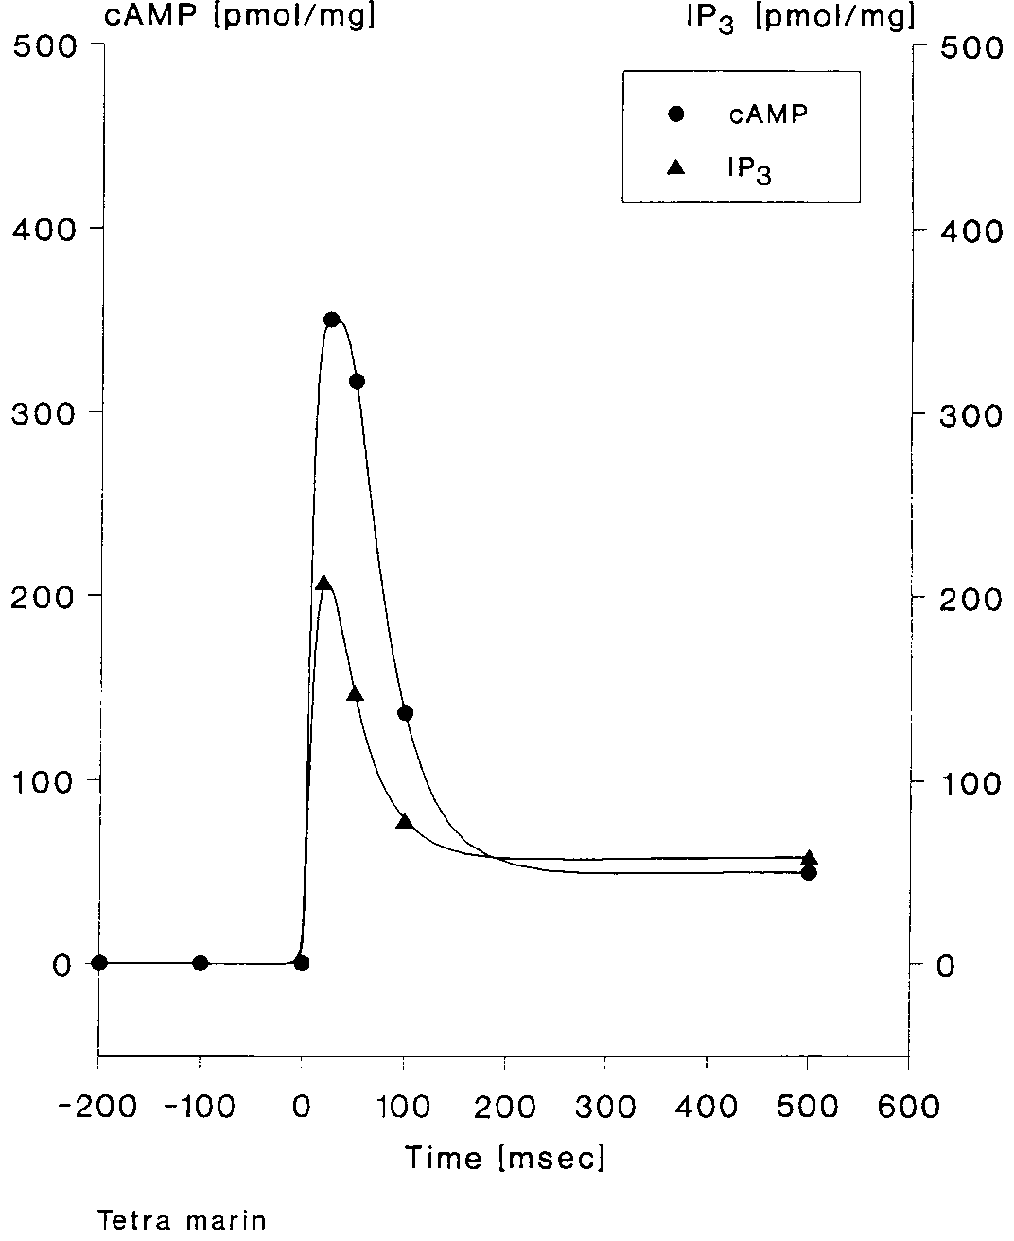
Odor rapidly changes dendritic second messengers
Boekhoff and colleagues isolated membranes enriched from the outer dendrites of Panulirus olfactory hairs. A quench-flow assay mixes membrane material with stimulus and rapidly stops the reaction, allowing biochemical changes over milliseconds to be measured independently of spike output.
Food extract produced transient increases in cAMP and inositol 1,4,5-trisphosphate, or IP3, peaking within approximately 50 ms. IP3 is a signaling molecule produced from membrane phosphoinositides. The timing is fast enough to participate in early sensory transduction rather than only a delayed behavioral response.
The assay establishes rapid odor-associated biochemical signaling in pooled dendritic material. Messenger levels that rise within about 50 ms place cAMP and IP3 early in the transduction sequence.
Boekhoff et al. (1994), Fig. 1. Odor evokes rapid cAMP and IP3 accumulation in dendritic membranes.
Corey et al. (2013), Fig. 4B, fluorescent row and original labels. IR25a immunofluorescence in aesthetasc dendrites with control labels intact.
Boekhoff et al. (1994); Corey et al. (2013)
35
Notes:
• Boekhoff and colleagues isolated membranes enriched from the outer dendrites of Panulirus olfactory hairs. A quench-flow assay mixes membrane material with stimulus and rapidly stops the reaction, allowing biochemical changes over milliseconds to be measured independently of spike output.
– A rapid biochemical response can be compatible with a causal transduction role without proving it. Necessity would require selectively disrupting that response while preserving other cellular functions and measuring sensory output.
• Food extract produced transient increases in cAMP and inositol 1,4,5-trisphosphate, or IP3, peaking within approximately 50 ms. IP3 is a signaling molecule produced from membrane phosphoinositides. The timing is fast enough to participate in early sensory transduction rather than only a delayed behavioral response.
• The assay establishes rapid odor-associated biochemical signaling in pooled dendritic material. Messenger levels that rise within about 50 ms place cAMP and IP3 early in the transduction sequence.
References:
Boekhoff I, Michel WC, Breer H, Ache BW (1994). Single odors differentially stimulate dual second messenger pathways in lobster olfactory receptor cells. The Journal of Neuroscience 14(5):3304-3309. https://doi.org/10.1523/jneurosci.14-05-03304.1994
Corey EA, Bobkov Y, Ukhanov K, Ache BW (2013). Ionotropic Crustacean Olfactory Receptors. PLoS ONE 8(4):e60551. https://doi.org/10.1371/journal.pone.0060551
Figure: Boekhoff et al. (1994), Fig. 1. Odor evokes rapid cAMP and IP3 accumulation in dendritic membranes.
Figure source: https://doi.org/10.1523/jneurosci.14-05-03304.1994
Figure: Corey et al. (2013), Fig. 4B, fluorescent row and original labels. IR25a immunofluorescence in aesthetasc dendrites with control labels intact.
Figure source: https://doi.org/10.1371/journal.pone.0060551

Slide 47
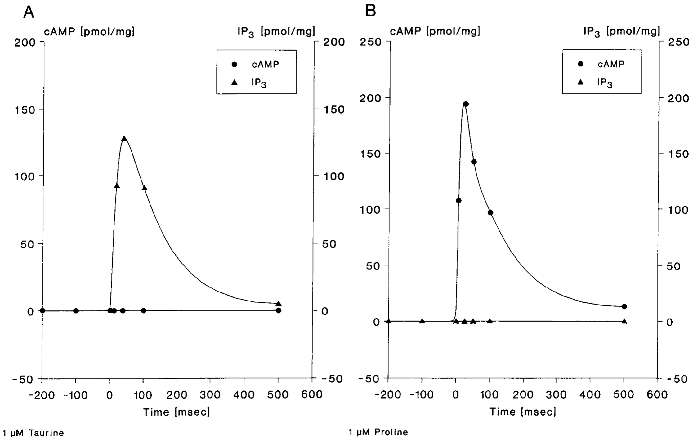
Ligand concentration changes messenger recruitment
Boekhoff and colleagues compared taurine and proline because individual ligands can excite one lobster sensory neuron yet inhibit another. At 1 µM, taurine preferentially elevated IP3 and proline preferentially elevated cAMP in isolated dendritic membranes. The published plots show these distinct low-dose time courses.
At 100 µM, both ligands elevated both signals while retaining different preferences. Taurine produced peak IP3 near 630 pmol/mg and cAMP near 280 pmol/mg; proline produced cAMP near 720 pmol/mg and IP3 near 220 pmol/mg.
The concentration dependence argues against assigning each ligand an exclusively fixed messenger pathway. Ligand identity biases which messenger rises most, and ligand concentration determines whether one or both messengers are recruited.
Boekhoff et al. (1994), Fig. 3A–B. Taurine and proline differ in second-messenger recruitment.
Corey et al. (2013), Fig. 4B, fluorescent row and original labels. IR25a immunofluorescence in aesthetasc dendrites with control labels intact.
Boekhoff et al. (1994); Corey et al. (2013)
36
Notes:
• Boekhoff and colleagues compared taurine and proline because individual ligands can excite one lobster sensory neuron yet inhibit another. At 1 µM, taurine preferentially elevated IP3 and proline preferentially elevated cAMP in isolated dendritic membranes. The published plots show these distinct low-dose time courses.
– The illustrated low-dose figure and the stated higher-dose values answer complementary questions. The higher-dose measurements come from Figure 4 of the same paper, rather than a numerical extrapolation from the displayed traces.
• At 100 µM, both ligands elevated both signals while retaining different preferences. Taurine produced peak IP3 near 630 pmol/mg and cAMP near 280 pmol/mg; proline produced cAMP near 720 pmol/mg and IP3 near 220 pmol/mg.
• The concentration dependence argues against assigning each ligand an exclusively fixed messenger pathway. Ligand identity biases which messenger rises most, and ligand concentration determines whether one or both messengers are recruited.
References:
Boekhoff I, Michel WC, Breer H, Ache BW (1994). Single odors differentially stimulate dual second messenger pathways in lobster olfactory receptor cells. The Journal of Neuroscience 14(5):3304-3309. https://doi.org/10.1523/jneurosci.14-05-03304.1994
Corey EA, Bobkov Y, Ukhanov K, Ache BW (2013). Ionotropic Crustacean Olfactory Receptors. PLoS ONE 8(4):e60551. https://doi.org/10.1371/journal.pone.0060551
Figure: Boekhoff et al. (1994), Fig. 3A–B. Taurine and proline differ in second-messenger recruitment.
Figure source: https://doi.org/10.1523/jneurosci.14-05-03304.1994
Figure: Corey et al. (2013), Fig. 4B, fluorescent row and original labels. IR25a immunofluorescence in aesthetasc dendrites with control labels intact.
Figure source: https://doi.org/10.1371/journal.pone.0060551

Slide 48
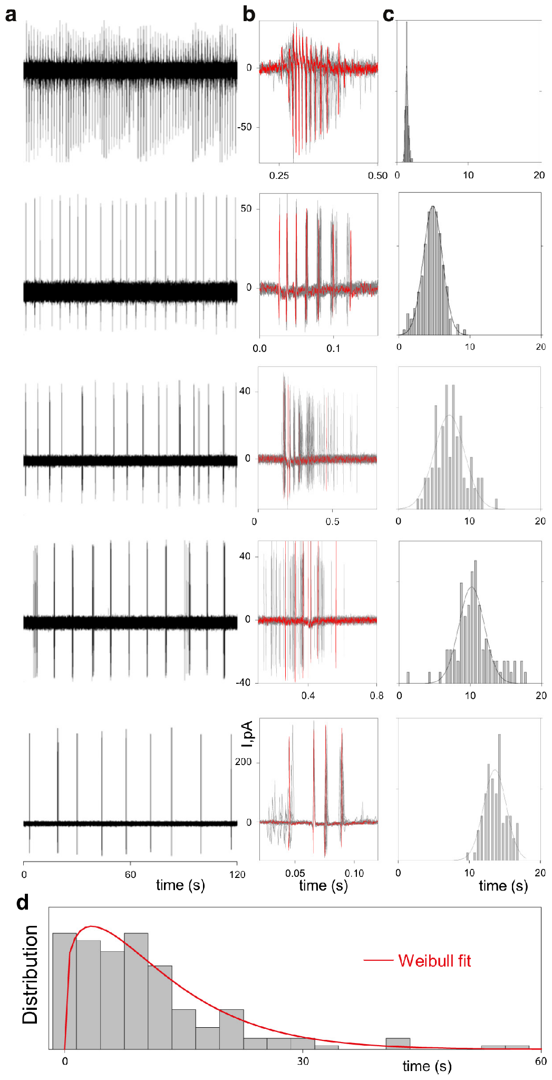
Bursting neurons supply diverse temporal reference scales
Park and colleagues recorded bursting olfactory receptor neurons and quantified the intervals between spontaneous bursts. A quasiperiodic oscillator repeats approximately, with variability rather than a perfectly fixed period. Such intrinsic activity offers a possible reference against which incoming odor encounters can be registered.
The recorded cells displayed different mean burst intervals and within-cell variation. Some repeated over a few seconds, whereas others had substantially longer intervals. The original figure compares electrical records and interval distributions, establishing diversity in measured cellular timing before a population decoder is proposed.
Each bursting neuron carries its own mean interval and variability, so a population of such cells offers many temporal references against which odor encounters can be registered.
Corey et al. (2013), Fig. 4C, fluorescent row. IR25a in somata and inner dendrites; control shown.
Park et al. (2014), Fig. 1a–d. Recorded spontaneous bursts and distribution of intrinsic periods.
Park et al. (2014); Corey et al. (2013)
37
Notes:
• Park and colleagues recorded bursting olfactory receptor neurons and quantified the intervals between spontaneous bursts. A quasiperiodic oscillator repeats approximately, with variability rather than a perfectly fixed period. Such intrinsic activity offers a possible reference against which incoming odor encounters can be registered.
– A quasiperiodic cell is not a stopwatch with a perfectly reproducible tick. Trial-to-trial variability must be incorporated when evaluating how much information its response carries.
• The recorded cells displayed different mean burst intervals and within-cell variation. Some repeated over a few seconds, whereas others had substantially longer intervals. The original figure compares electrical records and interval distributions, establishing diversity in measured cellular timing before a population decoder is proposed.
• Each bursting neuron carries its own mean interval and variability, so a population of such cells offers many temporal references against which odor encounters can be registered.
References:
Park IM, Bobkov YV, Ache BW, Príncipe JC (2014). Intermittency Coding in the Primary Olfactory System: A Neural Substrate for Olfactory Scene Analysis. The Journal of Neuroscience 34(3):941-952. https://doi.org/10.1523/jneurosci.2204-13.2014
Corey EA, Bobkov Y, Ukhanov K, Ache BW (2013). Ionotropic Crustacean Olfactory Receptors. PLoS ONE 8(4):e60551. https://doi.org/10.1371/journal.pone.0060551
Figure: Park et al. (2014), Fig. 1a–d. Recorded spontaneous bursts and distribution of intrinsic periods.
Figure source: https://doi.org/10.1523/jneurosci.2204-13.2014
Figure: Corey et al. (2013), Fig. 4C, fluorescent row. IR25a in somata and inner dendrites; control shown.
Figure source: https://doi.org/10.1371/journal.pone.0060551

Slide 49
A bursting neuron works as a quasiperiodic oscillator
An oscillator is a system that repeats its activity cycle, and a quasiperiodic oscillator repeats approximately, with variability rather than a perfectly fixed period. A bursting neuron fires a cluster of spikes in each cycle and then falls quiet before the next cluster.
Park and colleagues recorded bursting olfactory receptor neurons and quantified the intervals between spontaneous bursts. The cells displayed different mean intervals and within-cell variation. Some repeated over a few seconds, whereas others had substantially longer intervals.
Each neuron carries its own internal cycle, so a population supplies many different temporal reference scales. Incoming odor encounters can be registered against these cycles, which is the basis of the population decoder analysis.
Corey et al. (2013), Fig. 4C, fluorescent row. IR25a in somata and inner dendrites; control shown.
Park et al. (2014), Fig. 1a–d. Recorded spontaneous bursts and distribution of intrinsic periods.
Park et al. (2014); Corey et al. (2013)
37a
Notes:
• Spontaneous bursting gives a neuron an internal clock.
• Definition.
– An oscillator repeats its activity cycle.
– A quasiperiodic oscillator repeats approximately, with variability.
• Bursts.
– A burst is a cluster of spikes separated from another cluster by a quieter interval.
• Recordings.
– Park and colleagues quantified intervals between spontaneous bursts.
• Diversity.
– Cells differed in mean interval and within-cell variation.
– Some repeated over a few seconds and others had longer intervals.
• Reference scales.
– A population supplies many temporal references.
• Meaning.
– Odor encounters can be registered against these internal cycles.
• Period.
– The period is the time between successive bursts.
– In a quasiperiodic oscillator the period varies from cycle to cycle.
• Population.
– Cells with different periods act together as a set of references.
– A single cell would register encounters against only one cycle.
• Why variability matters.
– A perfectly fixed period would give every encounter the same relationship to the cycle.
– Variability means that the relationship changes from cycle to cycle.
– Cells with different periods give a population different reference points.
References:
Park IM, Bobkov YV, Ache BW, Príncipe JC (2014). Intermittency Coding in the Primary Olfactory System: A Neural Substrate for Olfactory Scene Analysis. The Journal of Neuroscience 34(3):941-952. https://doi.org/10.1523/jneurosci.2204-13.2014
Corey EA, Bobkov Y, Ukhanov K, Ache BW (2013). Ionotropic Crustacean Olfactory Receptors. PLoS ONE 8(4):e60551. https://doi.org/10.1371/journal.pone.0060551

Slide 50
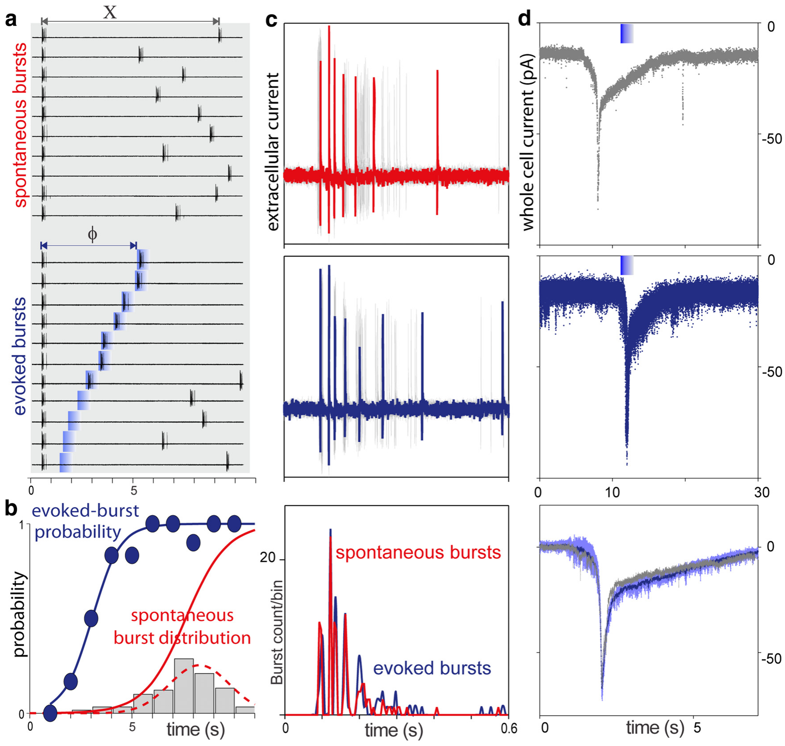
Odor-response probability depends on bursting phase
Phase describes where a neuron lies within its recurring burst cycle. Park and colleagues delivered comparable odor pulses at different times after the previous spontaneous burst. This manipulation tests whether the same chemical input has different effects depending on the cell’s current state.
In an example cell, burst probability was about 50% when odor arrived 3 s after the preceding burst and approached 100% at 6 s. The same intensity therefore did not guarantee the same output. Recordings also showed odor-related changes in electrical activity and burst timing.
The result establishes history-dependent sensory responsiveness. A population with different periods could jointly report encounter timing, because each cell responds according to where it lies in its own cycle.
Park et al. (2014), Fig. 2a–d. Stimulus timing changes burst probability and sensory responses.
Corey et al. (2013), Fig. 4C, fluorescent row. IR25a in somata and inner dendrites; control shown.
Park et al. (2014); Corey et al. (2013)
38
Notes:
• Phase describes where a neuron lies within its recurring burst cycle. Park and colleagues delivered comparable odor pulses at different times after the previous spontaneous burst. This manipulation tests whether the same chemical input has different effects depending on the cell’s current state.
– A refractory or low-responsiveness phase can conceal an encounter in one cell. Other cells at different phases could respond, making population activity more informative than a single-neuron yes-or-no response.
• In an example cell, burst probability was about 50% when odor arrived 3 s after the preceding burst and approached 100% at 6 s. The same intensity therefore did not guarantee the same output. Recordings also showed odor-related changes in electrical activity and burst timing.
• The result establishes history-dependent sensory responsiveness. A population with different periods could jointly report encounter timing, because each cell responds according to where it lies in its own cycle.
References:
Park IM, Bobkov YV, Ache BW, Príncipe JC (2014). Intermittency Coding in the Primary Olfactory System: A Neural Substrate for Olfactory Scene Analysis. The Journal of Neuroscience 34(3):941-952. https://doi.org/10.1523/jneurosci.2204-13.2014
Corey EA, Bobkov Y, Ukhanov K, Ache BW (2013). Ionotropic Crustacean Olfactory Receptors. PLoS ONE 8(4):e60551. https://doi.org/10.1371/journal.pone.0060551
Figure: Park et al. (2014), Fig. 2a–d. Stimulus timing changes burst probability and sensory responses.
Figure source: https://doi.org/10.1523/jneurosci.2204-13.2014
Figure: Corey et al. (2013), Fig. 4C, fluorescent row. IR25a in somata and inner dendrites; control shown.
Figure source: https://doi.org/10.1371/journal.pone.0060551

Slide 51
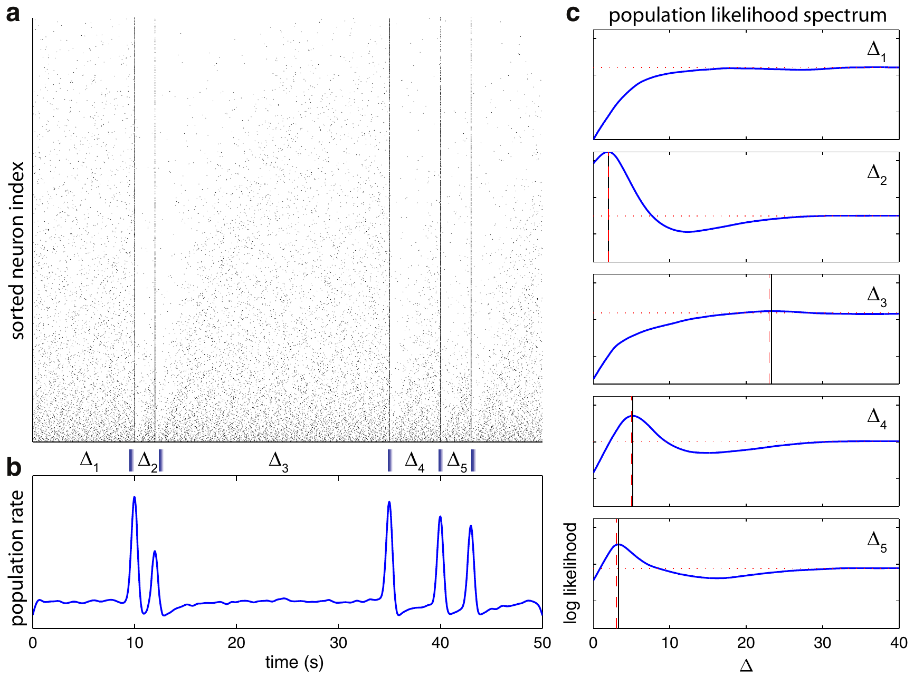
A published decoder tests the timing-code hypothesis
Park and colleagues fitted oscillator-response models using experimentally measured properties of bursting neurons, then combined 2,000 synthetic neurons into a population. A decoder is an analysis rule that estimates an input from output activity. It tests whether measured response rules could carry temporal information.
The model estimated intervals among presented events, including inputs at 10, 12, 35, 40 and 43 s. Combining cells with different intrinsic periods improved access to the time since a previous encounter. The displayed curves are the authors’ published synthetic-population results.
The decoder shows that combining cells with different intrinsic periods can carry information about the time since a previous encounter. Each synthetic neuron applies response rules measured in real bursting cells.
Park et al. (2014), Fig. 6a–c. Authors’ synthetic-population decoder estimates stimulus intervals.
Corey et al. (2013), Fig. 4C, fluorescent row. IR25a in somata and inner dendrites; control shown.
Park et al. (2014); Corey et al. (2013)
39
Notes:
• Park and colleagues fitted oscillator-response models using experimentally measured properties of bursting neurons, then combined 2,000 synthetic neurons into a population. A decoder is an analysis rule that estimates an input from output activity. It tests whether measured response rules could carry temporal information.
– A computationally available signal is not automatically read out by the animal. The model motivates a behavioral prediction, while its parameters and idealized decoder define the limits of that prediction.
• The model estimated intervals among presented events, including inputs at 10, 12, 35, 40 and 43 s. Combining cells with different intrinsic periods improved access to the time since a previous encounter. The displayed curves are the authors’ published synthetic-population results.
• The decoder shows that combining cells with different intrinsic periods can carry information about the time since a previous encounter. Each synthetic neuron applies response rules measured in real bursting cells.
References:
Park IM, Bobkov YV, Ache BW, Príncipe JC (2014). Intermittency Coding in the Primary Olfactory System: A Neural Substrate for Olfactory Scene Analysis. The Journal of Neuroscience 34(3):941-952. https://doi.org/10.1523/jneurosci.2204-13.2014
Corey EA, Bobkov Y, Ukhanov K, Ache BW (2013). Ionotropic Crustacean Olfactory Receptors. PLoS ONE 8(4):e60551. https://doi.org/10.1371/journal.pone.0060551
Figure: Park et al. (2014), Fig. 6a–c. Authors’ synthetic-population decoder estimates stimulus intervals.
Figure source: https://doi.org/10.1523/jneurosci.2204-13.2014
Figure: Corey et al. (2013), Fig. 4C, fluorescent row. IR25a in somata and inner dendrites; control shown.
Figure source: https://doi.org/10.1371/journal.pone.0060551

Slide 52
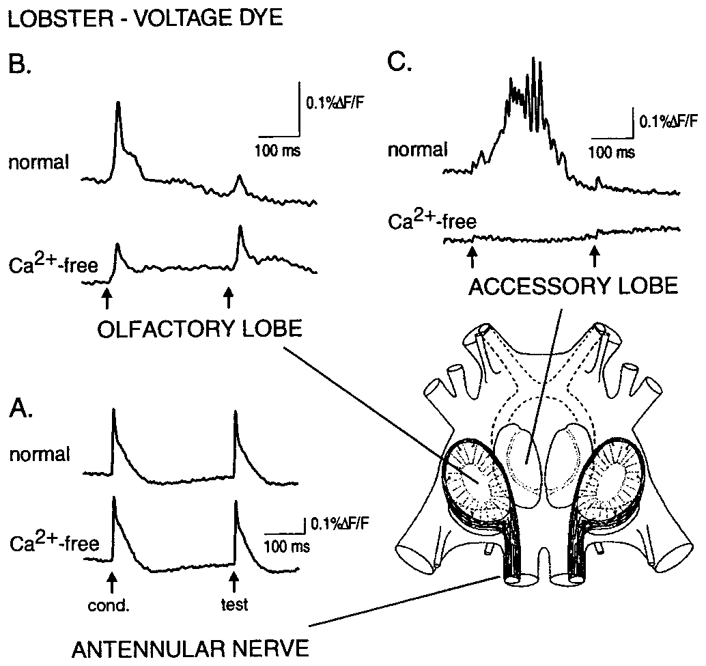
Central transmission can suppress repeated afferent input
An afferent neuron carries sensory input toward the brain. Wachowiak and Cohen electrically stimulated the lobster antennular nerve and recorded voltage-sensitive dye signals in the nerve and olfactory lobe. The published anatomy identifies the central region receiving these sensory axons.
Two 2-ms shocks separated by approximately 300–400 ms produced a smaller second response in the olfactory lobe, while the nerve response was less affected. Calcium-free, high-magnesium saline reduced synaptic transmission, helping separate incoming axonal signals from activity generated by the local network.
The comparison locates suppression beyond peripheral conduction in the tested preparation. A smaller second olfactory-lobe response alongside a preserved nerve response places the suppression at central synaptic transmission, where incoming information is modulated.
Wachowiak & Cohen (1999), Fig. 1A–C. Paired-shock responses in the olfactory lobe and antennular nerve.
Wachowiak & Cohen (1999)
40
Notes:
• An afferent neuron carries sensory input toward the brain. Wachowiak and Cohen electrically stimulated the lobster antennular nerve and recorded voltage-sensitive dye signals in the nerve and olfactory lobe. The published anatomy identifies the central region receiving these sensory axons.
– The olfactory lobe is a primary central processing region, not the sensory hair itself. Paired-pulse suppression compares the second response with the first while controlling the delivered electrical stimulus.
• Two 2-ms shocks separated by approximately 300–400 ms produced a smaller second response in the olfactory lobe, while the nerve response was less affected. Calcium-free, high-magnesium saline reduced synaptic transmission, helping separate incoming axonal signals from activity generated by the local network.
• The comparison locates suppression beyond peripheral conduction in the tested preparation. A smaller second olfactory-lobe response alongside a preserved nerve response places the suppression at central synaptic transmission, where incoming information is modulated.
References:
Wachowiak M, Cohen LB (1999). Presynaptic Inhibition of Primary Olfactory Afferents Mediated by Different Mechanisms in Lobster and Turtle. The Journal of Neuroscience 19(20):8808-8817. https://doi.org/10.1523/jneurosci.19-20-08808.1999
Figure: Wachowiak & Cohen (1999), Fig. 1A–C. Paired-shock responses in the olfactory lobe and antennular nerve.
Figure source: https://doi.org/10.1523/jneurosci.19-20-08808.1999

Slide 53
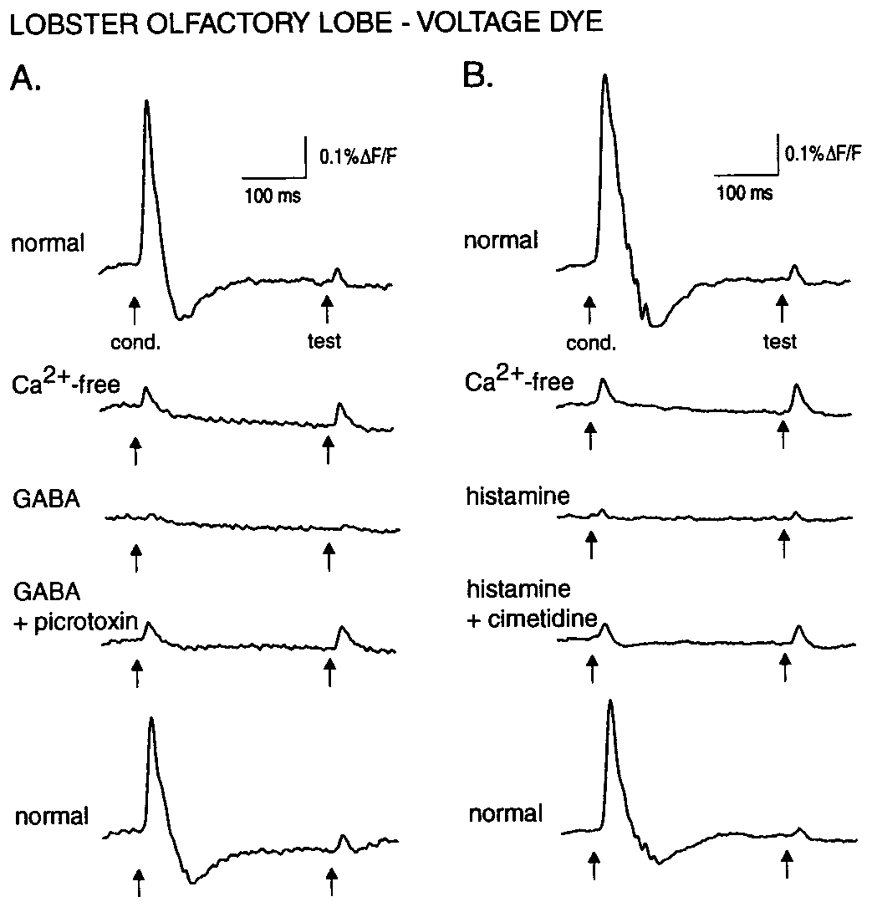
GABA and histamine inhibit lobster afferent transmission
GABA, gamma-aminobutyric acid, and histamine can act as neurotransmitters. Wachowiak and Cohen applied them while measuring lobster afferent voltage signals. Calcium-free conditions reduced network transmission, allowing drug effects on incoming sensory processes to be distinguished from ordinary downstream synaptic activity.
At 100 µM, histamine reduced the measured response by about 82% and GABA by about 45%. At 30 µM, histamine still reduced it by about 61%, whereas GABA had little effect. Responses recovered during washout, arguing against irreversible damage as the main explanation.
These dose-dependent effects support distinct inhibitory sensitivities of lobster afferent transmission. Shunting inhibition, proposed by the authors, is a ligand-gated conductance that lowers membrane resistance and reduces terminal spike amplitude or propagation.
Wachowiak & Cohen (1999), Fig. 2A–B. Histamine and GABA suppress lobster afferent voltage signals.
Wachowiak & Cohen (1999), Fig. 1A–C. Olfactory-lobe anatomy and original recording locations.
Wachowiak & Cohen (1999)
41
Notes:
• GABA, gamma-aminobutyric acid, and histamine can act as neurotransmitters. Wachowiak and Cohen applied them while measuring lobster afferent voltage signals. Calcium-free conditions reduced network transmission, allowing drug effects on incoming sensory processes to be distinguished from ordinary downstream synaptic activity.
– Presynaptic means acting on the input side of a synapse. Opening a shunting conductance allows current to leak across the membrane, reducing local voltage changes. A weaker spike can then reduce transmitter release; the channel’s exact molecular composition and natural behavioral recruitment were not measured here.
• At 100 µM, histamine reduced the measured response by about 82% and GABA by about 45%. At 30 µM, histamine still reduced it by about 61%, whereas GABA had little effect. Responses recovered during washout, arguing against irreversible damage as the main explanation.
• These dose-dependent effects support distinct inhibitory sensitivities of lobster afferent transmission. Shunting inhibition, proposed by the authors, is a ligand-gated conductance that lowers membrane resistance and reduces terminal spike amplitude or propagation.
References:
Wachowiak M, Cohen LB (1999). Presynaptic Inhibition of Primary Olfactory Afferents Mediated by Different Mechanisms in Lobster and Turtle. The Journal of Neuroscience 19(20):8808-8817. https://doi.org/10.1523/jneurosci.19-20-08808.1999
Figure: Wachowiak & Cohen (1999), Fig. 2A–B. Histamine and GABA suppress lobster afferent voltage signals.
Figure source: https://doi.org/10.1523/jneurosci.19-20-08808.1999
Figure: Wachowiak & Cohen (1999), Fig. 1A–C. Olfactory-lobe anatomy and original recording locations.
Figure source: https://doi.org/10.1523/jneurosci.19-20-08808.1999

Slide 54
Presynaptic inhibition reduces transmitter release
Presynaptic inhibition reduces transmitter release from an axon terminal by acting on the terminal itself, so the target neuron receives less input without being inhibited directly. In the olfactory lobe it acts on the incoming afferent axons. Both GABA and histamine therefore act on afferent transmission.
Wachowiak and Cohen applied GABA and histamine while recording afferent voltage signals in calcium-free, high-magnesium saline. At 100 µM, histamine reduced the response by about 82% and GABA by about 45%, and responses recovered during washout.
Picrotoxin blocked the GABA effect and cimetidine reduced the histamine effect, which separates two inhibitory receptor actions. An isolated nerve segment was comparatively unaffected, supporting a locus at the central terminals of the afferents.
Wachowiak & Cohen (1999), Fig. 2A–B. Histamine and GABA suppress lobster afferent voltage signals.
Wachowiak & Cohen (1999), Fig. 1A–C. Olfactory-lobe anatomy and original recording locations.
Wachowiak & Cohen (1999)
41a
Notes:
• Presynaptic inhibition regulates sensory input before it is passed on.
• Definition.
– Presynaptic inhibition reduces transmitter release from an axon terminal.
– The target neuron receives less input.
• Transmitters.
– GABA and histamine can act as neurotransmitters.
• Solution.
– Calcium-free, high-magnesium saline reduced network transmission.
– Drug effects on afferents could be isolated.
• Dose effects.
– At 100 micromolar, histamine reduced the response by about 82 percent and GABA by about 45 percent.
• Recovery.
– Responses recovered during washout.
• Antagonists.
– Picrotoxin blocked the GABA effect.
– Cimetidine reduced the histamine effect.
• Calcium-free saline.
– Removing calcium reduces transmission at the synapses of the network.
– Responses from incoming axons can then be measured on their own.
• Reversibility.
– Washout restored the responses.
– The drugs therefore did not damage the preparation permanently.
• Dose dependence.
– At 30 micromolar, histamine still reduced the response by about 61 percent.
– GABA had little effect at that dose.
– The two transmitters therefore differ in potency.
– Potency was compared at each dose.
References:
Wachowiak M, Cohen LB (1999). Presynaptic Inhibition of Primary Olfactory Afferents Mediated by Different Mechanisms in Lobster and Turtle. The Journal of Neuroscience 19(20):8808-8817. https://doi.org/10.1523/jneurosci.19-20-08808.1999

Slide 55
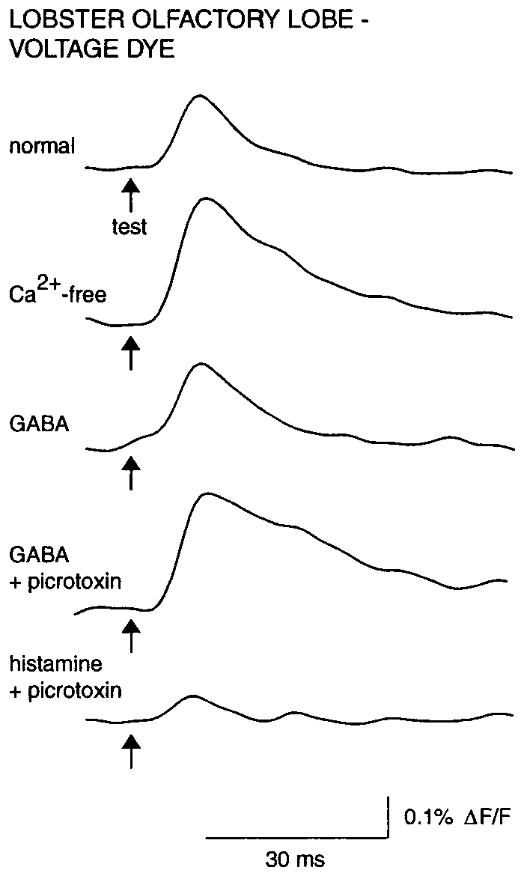
Antagonists distinguish two inhibitory receptor actions
A receptor antagonist reduces activation of a receptor by its ligand. Wachowiak and Cohen used picrotoxin to test GABA-sensitive inhibition and cimetidine to test histamine-sensitive inhibition in lobster olfactory afferents. The pharmacological comparisons followed control recordings from the same preparation.
Picrotoxin at 100 µM blocked the GABA effect, whereas histamine inhibition persisted. Cimetidine at 5 mM reduced the histamine effect without producing the same blockade of GABA. The separation argues that the transmitters do not act through one indistinguishable receptor mechanism.
Picrotoxin blocks the GABA effect and cimetidine reduces the histamine effect, which separates two inhibitory receptor actions. An isolated nerve segment was comparatively unaffected, supporting a central-terminal locus.
Wachowiak & Cohen (1999), Fig. 3. Histamine inhibition persists after GABA-receptor blockade.
Wachowiak & Cohen (1999), Fig. 1A–C. Olfactory-lobe anatomy and original recording locations.
Wachowiak & Cohen (1999)
42
Notes:
• A receptor antagonist reduces activation of a receptor by its ligand. Wachowiak and Cohen used picrotoxin to test GABA-sensitive inhibition and cimetidine to test histamine-sensitive inhibition in lobster olfactory afferents. The pharmacological comparisons followed control recordings from the same preparation.
– Histamine used as a central transmitter must be distinguished from histamine delivered as an odorant to sensory dendrites in other experiments. Site of application and the recorded response determine which role is being tested.
• Picrotoxin at 100 µM blocked the GABA effect, whereas histamine inhibition persisted. Cimetidine at 5 mM reduced the histamine effect without producing the same blockade of GABA. The separation argues that the transmitters do not act through one indistinguishable receptor mechanism.
• Picrotoxin blocks the GABA effect and cimetidine reduces the histamine effect, which separates two inhibitory receptor actions. An isolated nerve segment was comparatively unaffected, supporting a central-terminal locus.
References:
Wachowiak M, Cohen LB (1999). Presynaptic Inhibition of Primary Olfactory Afferents Mediated by Different Mechanisms in Lobster and Turtle. The Journal of Neuroscience 19(20):8808-8817. https://doi.org/10.1523/jneurosci.19-20-08808.1999
Figure: Wachowiak & Cohen (1999), Fig. 3. Histamine inhibition persists after GABA-receptor blockade.
Figure source: https://doi.org/10.1523/jneurosci.19-20-08808.1999
Figure: Wachowiak & Cohen (1999), Fig. 1A–C. Olfactory-lobe anatomy and original recording locations.
Figure source: https://doi.org/10.1523/jneurosci.19-20-08808.1999

Slide 56
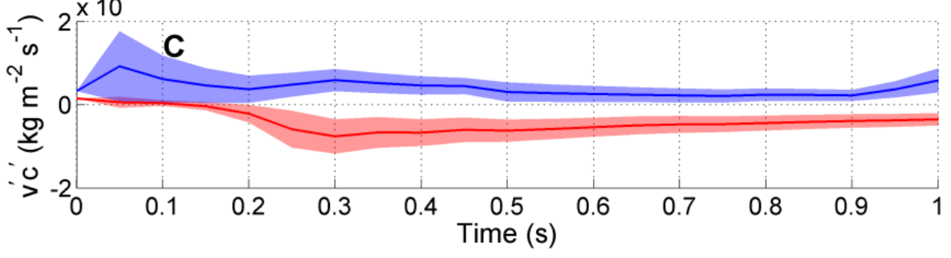
Joint odor and flow sampling offers direction cues
Odor flux combines chemical concentration with the motion carrying that chemical. Pravin and Reidenbach measured flow and fluorescent concentration in a flume, then developed a three-dimensional fluid model constrained by those measurements. This addresses direction information unavailable from concentration alone.
The authors’ published model showed transverse chemical transport toward the plume center on opposite sides of the plume. Useful differences emerged over averaging intervals of approximately 0.5 s. The displayed colored traces are their modeled transverse flux, not trajectories or neural recordings from lobsters.
Joint chemical and mechanical sensing can provide a directional cue, because transverse flux points toward the plume center from opposite sides of the plume. Averaging over about 0.5 s is enough for the difference to emerge.
Pravin & Reidenbach (2013), Fig. 11C. Authors’ modeled transverse odor flux on opposite sides of a plume.
Pravin & Reidenbach (2013); Horner et al. (2004)
43
Notes:
• Odor flux combines chemical concentration with the motion carrying that chemical. Pravin and Reidenbach measured flow and fluorescent concentration in a flume, then developed a three-dimensional fluid model constrained by those measurements. This addresses direction information unavailable from concentration alone.
– Transverse means across the main flow direction. A concentration reading can signal presence, while correlated fluctuations in flow can additionally indicate where odor-bearing water is being transported.
• The authors’ published model showed transverse chemical transport toward the plume center on opposite sides of the plume. Useful differences emerged over averaging intervals of approximately 0.5 s. The displayed colored traces are their modeled transverse flux, not trajectories or neural recordings from lobsters.
• Joint chemical and mechanical sensing can provide a directional cue, because transverse flux points toward the plume center from opposite sides of the plume. Averaging over about 0.5 s is enough for the difference to emerge.
References:
Pravin S, Reidenbach MA (2013). Simultaneous Sampling of Flow and Odorants by Crustaceans can Aid Searches within a Turbulent Plume. Sensors 13(12):16591-16610. https://doi.org/10.3390/s131216591
Horner AJ, Weissburg MJ, Derby CD (2004). Dual antennular chemosensory pathways can mediate orientation by Caribbean spiny lobsters in naturalistic flow conditions. Journal of Experimental Biology 207(21):3785-3796. https://doi.org/10.1242/jeb.01200
Figure: Pravin & Reidenbach (2013), Fig. 11C. Authors’ modeled transverse odor flux on opposite sides of a plume.
Figure source: https://doi.org/10.3390/s131216591

Slide 57
Odor flux adds flow direction to concentration
Odor flux is the transport of odor past a point, calculated by combining concentration with the velocity of the water that carries it. Concentration alone has no direction, whereas flux has a direction set by the flow, so the same concentration can represent very different transport depending on the current.
Pravin and Reidenbach measured flow and fluorescent concentration in a flume and built a three-dimensional fluid model constrained by those measurements. The model showed transverse chemical transport toward the plume center on opposite sides of the plume, with useful differences over averaging intervals of about 0.5 s, so the averaging window shapes the directional information.
Sampling flow and odor together therefore gives a directional cue about where the plume center lies. Joint chemical and mechanical sensing extracts the side of the plume on which an animal sits, information that concentration measured alone does not supply, and this side-specific information guides the animal toward the center.
Pravin & Reidenbach (2013), Fig. 11C. Authors’ modeled transverse odor flux on opposite sides of a plume.
Pravin & Reidenbach (2013); Horner et al. (2004)
43a
Notes:
• Odor flux combines two measurements into a directional quantity.
• Definition.
– Odor flux combines chemical concentration with the motion of the water carrying it.
• Direction.
– Concentration alone has no direction.
– Flux has a direction set by the flow.
• Measurements.
– Flow and fluorescent concentration were measured in a flume.
– A three-dimensional fluid model was constrained by them.
• Model result.
– Transverse transport pointed toward the plume center on opposite sides of the plume.
• Time window.
– Useful differences emerged over averaging intervals of approximately 0.5 seconds.
• Meaning.
– Joint sensing offers a cue about which side of the plume an animal occupies.
• Modeled traces.
– The displayed colored traces are modeled transverse flux.
– They are not trajectories or neural recordings from lobsters.
• Why flow matters.
– A concentration reading says how much odor is present.
– A flux reading also says which way the odor is moving.
• Averaging window.
– Differences in transverse flux emerged when measurements were averaged over about half a second.
– A shorter window would contain more fluctuation.
– A window of this length is brief enough for an animal sampling continuously.
References:
Pravin S, Reidenbach MA (2013). Simultaneous Sampling of Flow and Odorants by Crustaceans can Aid Searches within a Turbulent Plume. Sensors 13(12):16591-16610. https://doi.org/10.3390/s131216591
Horner AJ, Weissburg MJ, Derby CD (2004). Dual antennular chemosensory pathways can mediate orientation by Caribbean spiny lobsters in naturalistic flow conditions. Journal of Experimental Biology 207(21):3785-3796. https://doi.org/10.1242/jeb.01200

Slide 58
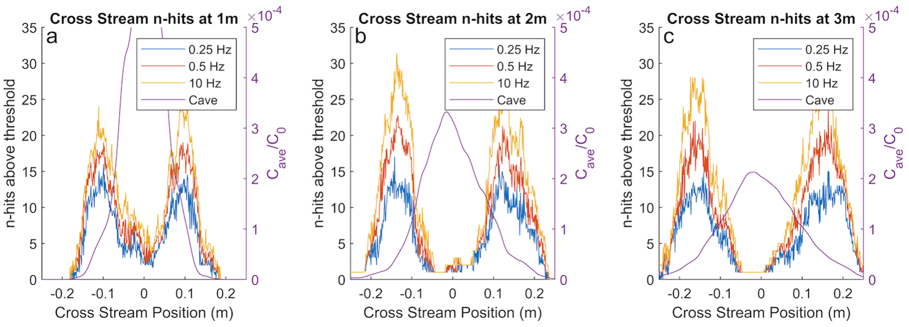
Plume intermittency supplies a different spatial statistic
Intermittency describes the temporal discontinuity of odor. Michaelis and colleagues quantified it as the count of concentration spikes crossing a threshold within a time window. Michaelis and colleagues used a turbulent-plume model validated against laboratory fluorescence and velocity measurements. They compared intermittency with concentration as potential information for aquatic odor-source tracking.
The model covered a 5 × 0.5 × 0.15 m domain with mean flow near 0.02 m/s. Intermittency profiles depended on cross-stream position and the observation window. At plume edges, bilateral differences in encounter frequency could remain informative when instantaneous concentration was unreliable.
Intermittency complements a mean concentration reading by adding a count of threshold crossings, and bilateral differences in that count can mark a position within the plume.
Michaelis et al. (2020), Fig. 6. Authors’ modeled concentration-spike counts across the plume at different sampling frequencies.
Michaelis et al. (2020)
44
Notes:
• Intermittency describes the temporal discontinuity of odor. Michaelis and colleagues quantified it as the count of concentration spikes crossing a threshold within a time window. Michaelis and colleagues used a turbulent-plume model validated against laboratory fluorescence and velocity measurements. They compared intermittency with concentration as potential information for aquatic odor-source tracking.
– A threshold defines an encounter when concentration crosses from below to above it. Its choice can change encounter counts, so an intermittency code requires a biologically plausible detector as well as a physically realistic plume.
• The model covered a 5 × 0.5 × 0.15 m domain with mean flow near 0.02 m/s. Intermittency profiles depended on cross-stream position and the observation window. At plume edges, bilateral differences in encounter frequency could remain informative when instantaneous concentration was unreliable.
• Intermittency complements a mean concentration reading by adding a count of threshold crossings, and bilateral differences in that count can mark a position within the plume.
References:
Michaelis BT, Leathers KW, Bobkov YV, Ache BW, Principe JC, Baharloo R, Park IM, Reidenbach MA (2020). Odor tracking in aquatic organisms: the importance of temporal and spatial intermittency of the turbulent plume. Scientific Reports 10(1):7961. https://doi.org/10.1038/s41598-020-64766-y
Figure: Michaelis et al. (2020), Fig. 6. Authors’ modeled concentration-spike counts across the plume at different sampling frequencies.
Figure source: https://doi.org/10.1038/s41598-020-64766-y

Slide 59
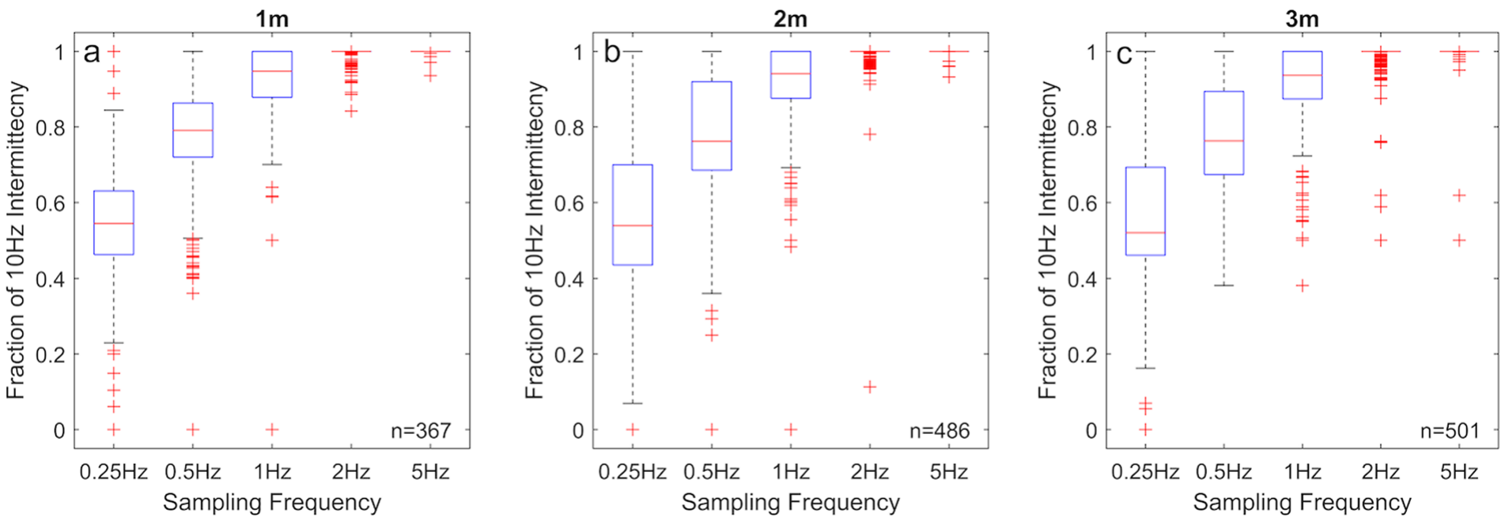
Search combines sampling, neural timing and context
Michaelis and colleagues compared modeled intermittency estimates at different sampling frequencies and tested simulated search rules. The original figure shows how a finite observation window and sample schedule affect the estimated chemical statistic. This makes sampling strategy part of the navigation hypothesis rather than a passive detail.
Their results support temporal encounter information alongside concentration under specified plume conditions. Earlier measurements show why those conditions matter: flicking changes encounter gaps, bursting neurons respond according to recent history, and removing one antennular pathway can preserve arrival while reducing path straightness.
Together, the studies link physical acquisition, peripheral coding and source-directed behavior into one chain from plume to path. Measured fluid patterns, recorded neuronal responses and animal trajectories each supply one link in that chain.
Michaelis et al. (2020), Fig. 7. Authors’ model compares detected concentration-spike counts at different sampling frequencies.
Michaelis et al. (2020); Reidenbach & Koehl (2011); Park et al. (2014); Horner et al. (2004)
45
Notes:
• Michaelis and colleagues compared modeled intermittency estimates at different sampling frequencies and tested simulated search rules. The original figure shows how a finite observation window and sample schedule affect the estimated chemical statistic. This makes sampling strategy part of the navigation hypothesis rather than a passive detail.
– The strongest next test would manipulate a specific timing mechanism while preserving chemical detection, then measure path efficiency under controlled plume statistics. That experiment would link a proposed neural code to its behavioral consequence.
• Their results support temporal encounter information alongside concentration under specified plume conditions. Earlier measurements show why those conditions matter: flicking changes encounter gaps, bursting neurons respond according to recent history, and removing one antennular pathway can preserve arrival while reducing path straightness.
• Together, the studies link physical acquisition, peripheral coding and source-directed behavior into one chain from plume to path. Measured fluid patterns, recorded neuronal responses and animal trajectories each supply one link in that chain.
References:
Michaelis BT, Leathers KW, Bobkov YV, Ache BW, Principe JC, Baharloo R, Park IM, Reidenbach MA (2020). Odor tracking in aquatic organisms: the importance of temporal and spatial intermittency of the turbulent plume. Scientific Reports 10(1):7961. https://doi.org/10.1038/s41598-020-64766-y
Reidenbach MA, Koehl MAR (2011). The spatial and temporal patterns of odors sampled by lobsters and crabs in a turbulent plume. Journal of Experimental Biology 214(18):3138–3153. https://doi.org/10.1242/jeb.057547
Park IM, Bobkov YV, Ache BW, Príncipe JC (2014). Intermittency Coding in the Primary Olfactory System: A Neural Substrate for Olfactory Scene Analysis. The Journal of Neuroscience 34(3):941-952. https://doi.org/10.1523/jneurosci.2204-13.2014
Horner AJ, Weissburg MJ, Derby CD (2004). Dual antennular chemosensory pathways can mediate orientation by Caribbean spiny lobsters in naturalistic flow conditions. Journal of Experimental Biology 207(21):3785-3796. https://doi.org/10.1242/jeb.01200
Figure: Michaelis et al. (2020), Fig. 7. Authors’ model compares detected concentration-spike counts at different sampling frequencies.
Figure source: https://doi.org/10.1038/s41598-020-64766-y

Slide 60
Key takeaways
Behavior changes during approach Food odor changes walking speed, heading and close-range raking; successful paths do not follow one invariant turning program.
Sensory pathways overlap conditionally Either antennular chemical pathway can preserve source finding in Panulirus, while selective loss can reduce path efficiency.
Sniffing filters input mechanically Fast flicks replace water between aesthetascs; slow returns retain it, changing the timing and spatial pattern reaching receptors.
Expression does not establish receptor function IR localization and single-cell coexpression identify candidate machinery, but ligand specificity, channel composition and causal function require further tests.
Timing begins in the periphery Excitation, inhibition and intrinsic bursting occur in sensory neurons; phase-dependent responses can carry encounter-history information.
Navigation requires linked evidence Central inhibition changes transmission, while plume and decoding models propose usable cues; their behavioral necessity remains to be demonstrated.
Moore et al. (1991); Horner et al. (2004); Koehl et al. (2001); Corey et al. (2013); Kozma et al. (2020); Park et al. (2014)
46
Notes:
• Behavior changes during approach. Food odor changes walking speed, heading and close-range raking; successful paths do not follow one invariant turning program.
• Sensory pathways overlap conditionally. Either antennular chemical pathway can preserve source finding in Panulirus, while selective loss can reduce path efficiency.
• Sniffing filters input mechanically. Fast flicks replace water between aesthetascs; slow returns retain it, changing the timing and spatial pattern reaching receptors.
• Expression does not establish receptor function. IR localization and single-cell coexpression identify candidate machinery, but ligand specificity, channel composition and causal function require further tests.
• Timing begins in the periphery. Excitation, inhibition and intrinsic bursting occur in sensory neurons; phase-dependent responses can carry encounter-history information.
• Navigation requires linked evidence. Central inhibition changes transmission, while plume and decoding models propose usable cues; their behavioral necessity remains to be demonstrated.
References:
Moore PA, Scholz N, Atema J (1991). Chemical orientation of lobsters, homarus americanus, in turbulent odor plumes. Journal of Chemical Ecology 17(7):1293-1307. https://doi.org/10.1007/bf00983763
Horner AJ, Weissburg MJ, Derby CD (2004). Dual antennular chemosensory pathways can mediate orientation by Caribbean spiny lobsters in naturalistic flow conditions. Journal of Experimental Biology 207(21):3785-3796. https://doi.org/10.1242/jeb.01200
Koehl MAR, Koseff JR, Crimaldi JP, McCay MG, Cooper T, Wiley MB, Moore PA (2001). Lobster Sniffing: Antennule Design and Hydrodynamic Filtering of Information in an Odor Plume. Science 294(5548):1948-1951. https://doi.org/10.1126/science.1063724
Reidenbach MA, George NT, Koehl MAR (2008). Antennule morphology and flicking kinematics facilitate odor sampling by the spiny lobster, Panulirus argus. Journal of Experimental Biology 211(17):2849-2858. https://doi.org/10.1242/jeb.016394
Corey EA, Bobkov Y, Ukhanov K, Ache BW (2013). Ionotropic Crustacean Olfactory Receptors. PLoS ONE 8(4):e60551. https://doi.org/10.1371/journal.pone.0060551
Kozma MT, Ngo-Vu H, Rump MT, Bobkov YV, Ache BW, Derby CD (2020). Single cell transcriptomes reveal expression patterns of chemoreceptor genes in olfactory sensory neurons of the Caribbean spiny lobster, Panulirus argus. BMC Genomics 21(1):649. https://doi.org/10.1186/s12864-020-07034-7
Bobkov Y, Park I, Ukhanov K, Principe J, Ache B (2012). Cellular Basis for Response Diversity in the Olfactory Periphery. PLoS ONE 7(4):e34843. https://doi.org/10.1371/journal.pone.0034843
Michel WC, Ache BW (1992). Cyclic nucleotides mediate an odor-evoked potassium conductance in lobster olfactory receptor cells. The Journal of Neuroscience 12(10):3979-3984. https://doi.org/10.1523/jneurosci.12-10-03979.1992
Boekhoff I, Michel WC, Breer H, Ache BW (1994). Single odors differentially stimulate dual second messenger pathways in lobster olfactory receptor cells. The Journal of Neuroscience 14(5):3304-3309. https://doi.org/10.1523/jneurosci.14-05-03304.1994
Park IM, Bobkov YV, Ache BW, Príncipe JC (2014). Intermittency Coding in the Primary Olfactory System: A Neural Substrate for Olfactory Scene Analysis. The Journal of Neuroscience 34(3):941-952. https://doi.org/10.1523/jneurosci.2204-13.2014
Wachowiak M, Cohen LB (1999). Presynaptic Inhibition of Primary Olfactory Afferents Mediated by Different Mechanisms in Lobster and Turtle. The Journal of Neuroscience 19(20):8808-8817. https://doi.org/10.1523/jneurosci.19-20-08808.1999
Pravin S, Reidenbach MA (2013). Simultaneous Sampling of Flow and Odorants by Crustaceans can Aid Searches within a Turbulent Plume. Sensors 13(12):16591-16610. https://doi.org/10.3390/s131216591
Michaelis BT, Leathers KW, Bobkov YV, Ache BW, Principe JC, Baharloo R, Park IM, Reidenbach MA (2020). Odor tracking in aquatic organisms: the importance of temporal and spatial intermittency of the turbulent plume. Scientific Reports 10(1):7961. https://doi.org/10.1038/s41598-020-64766-y

