Slide 1
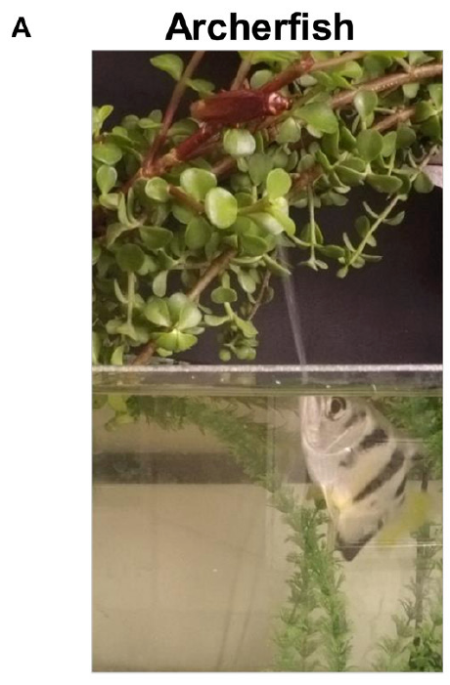
NEUR 411 · NEUROETHOLOGY · FALL 2026
Lecture 27
Archerfish: predictive aiming and ballistic prey capture
Wednesday, October 28, 2026
Jordan Lopez, Ph.D.
Professor of Neurobiology & Biomedical Engineering
Reichenthal et al. (2018), Fig. 1(A). Archerfish directing a water jet toward an aerial insect.
Notes:
Archerfish: predictive aiming and ballistic prey capture
Lecture 27. NEUR 411 · NEUROETHOLOGY · FALL 2026. Wednesday, October 28, 2026.
Figure: Reichenthal et al. (2018), Fig. 1(A). Archerfish directing a water jet toward an aerial insect.
Figure source: https://doi.org/10.3389/fncir.2018.00018
• Archerfish dislodge aerial prey with controlled water jets and initiate predictive starts toward a future water-entry point. The title photograph is Reichenthal et al. (2018), Figure 1A.
References:
Reichenthal A, Ben-Tov M, Segev R (2018). Coding Schemes in the Archerfish Optic Tectum. Frontiers in Neural Circuits 12: 18. https://doi.org/10.3389/fncir.2018.00018
Rossel S, Corlija J, Schuster S (2002). Predicting three-dimensional target motion: how archer fish determine where to catch their dislodged prey. Journal of Experimental Biology 205: 3321-3326. https://doi.org/10.1242/jeb.205.21.3321

Slide 2
A water shot and a predictive start secure aerial prey
Archerfish are aquatic predators that dislodge aerial prey with a directed water jet. In Toxotes jaculatrix, a successful shot releases an insect into a falling trajectory. Securing the food then requires reaching the water-entry point before another fish does; the shooter and nearby bystanders can both respond.
Rossel and colleagues recorded fish and dislodged flies from above. Responding fish initiated a rapid turn within approximately 100 ms, aligned toward the future landing point, and accelerated along that heading while the prey remained airborne. Shooting and interception therefore impose different motor demands.
Rossel and colleagues quantified the interception response of fish to dislodged flies, and Gerullis and Schuster quantified jet control at controlled target heights, so each behavior is measured in its own preparation.
Reichenthal et al. (2018), Fig. 1(A). Archerfish directing a water jet toward an aerial insect.
Rossel et al. (2002); Gerullis & Schuster (2014)
02
Notes:
• Archerfish are aquatic predators that dislodge aerial prey with a directed water jet. In Toxotes jaculatrix, a successful shot releases an insect into a falling trajectory. Securing the food then requires reaching the water-entry point before another fish does; the shooter and nearby bystanders can both respond.
– The photographed fish belongs to the visual-physiology preparation of Reichenthal and colleagues. The interception measurements and jet measurements come from separate primary experiments.
• Rossel and colleagues recorded fish and dislodged flies from above. Responding fish initiated a rapid turn within approximately 100 ms, aligned toward the future landing point, and accelerated along that heading while the prey remained airborne. Shooting and interception therefore impose different motor demands.
• Rossel and colleagues quantified the interception response of fish to dislodged flies, and Gerullis and Schuster quantified jet control at controlled target heights, so each behavior is measured in its own preparation.
References:
Rossel S, Corlija J, Schuster S (2002). Predicting three-dimensional target motion: how archer fish determine where to catch their dislodged prey. Journal of Experimental Biology 205: 3321-3326. https://doi.org/10.1242/jeb.205.21.3321
Gerullis P, Schuster S (2014). Archerfish Actively Control the Hydrodynamics of Their Jets. Current Biology 24: 2156-2160. https://doi.org/10.1016/j.cub.2014.07.059
Reichenthal A, Ben-Tov M, Segev R (2018). Coding Schemes in the Archerfish Optic Tectum. Frontiers in Neural Circuits 12: 18. https://doi.org/10.3389/fncir.2018.00018
Figure: Reichenthal et al. (2018), Fig. 1(A). Archerfish directing a water jet toward an aerial insect.
Figure source: https://doi.org/10.3389/fncir.2018.00018

Slide 3
A predictive start is aimed at the future landing point
A predictive start is a rapid turn and acceleration that sends a fish toward the point where prey will land, begun while the prey is still in the air. It differs from pursuit, in which the fish follows the current position of a visible target.
Rossel and colleagues recorded fish and dislodged flies from above. Responding fish initiated a rapid turn within approximately 100 ms, aligned toward the future landing point, and accelerated along that heading while the prey remained airborne.
Securing the food requires reaching the water-entry point before another fish does, so the turn must be aimed at a destination that the prey has not yet reached. The shooter and nearby bystanders can both respond.
Reichenthal et al. (2018), Fig. 1(A). Archerfish directing a water jet toward an aerial insect.
Rossel et al. (2002); Gerullis & Schuster (2014)
02a
Notes:
• A predictive start is the central behavior of this lecture.
• Definition.
– It is a rapid turn and acceleration toward the point where prey will land.
– It begins while the prey is still falling.
• Contrast with pursuit.
– Pursuit follows the current position of a visible target.
– A predictive start aims at a destination that does not yet contain the prey.
• The recordings.
– Rossel and colleagues filmed fish and dislodged flies from above.
– Responding fish turned within approximately 100 ms.
• Heading and acceleration.
– The turn aligned the body toward the future landing point.
– The fish then accelerated along that heading while the prey remained airborne.
• Competition.
– The fish that shoots and nearby bystanders can both respond.
– Reaching the water-entry point first secures the food.
• Two motor demands.
– Shooting requires control of a water jet, and interception requires a fast turn and acceleration.
– Gerullis and Schuster recorded shots at target heights of 20, 40 and 60 cm.
• Consequence.
– The motor command must specify a destination from early information about the prey.
References:
Rossel S, Corlija J, Schuster S (2002). Predicting three-dimensional target motion: how archer fish determine where to catch their dislodged prey. Journal of Experimental Biology 205: 3321-3326. https://doi.org/10.1242/jeb.205.21.3321
Gerullis P, Schuster S (2014). Archerfish Actively Control the Hydrodynamics of Their Jets. Current Biology 24: 2156-2160. https://doi.org/10.1016/j.cub.2014.07.059

Slide 4
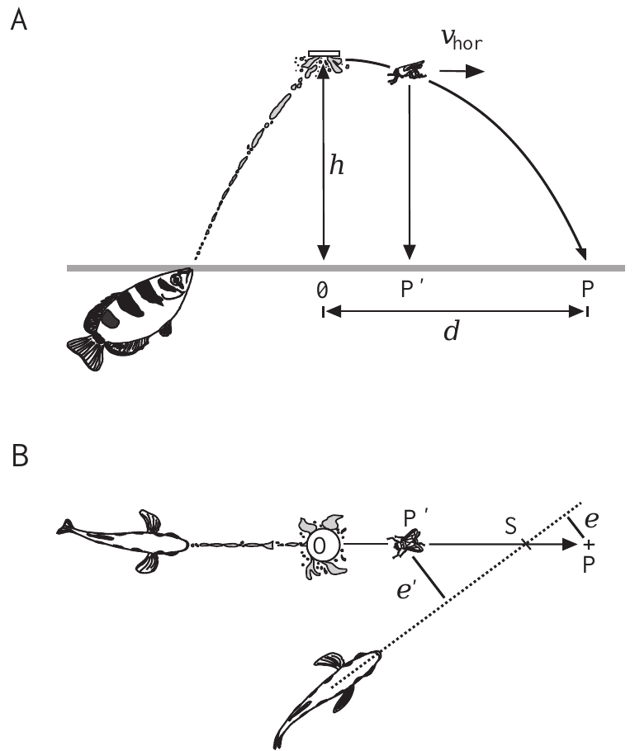
Controlled prey release separates two possible aims
A ballistic trajectory is motion dominated by initial velocity and gravity after release. Rossel and colleagues attached wet flies, approximately 50 mg, beneath a disk positioned 20 or 40 cm above the water. Overhead video sampled prey and fish positions at 20-ms intervals.
The investigators compared errors relative to two destinations: the eventual water-entry point and the prey’s horizontal position when the fish finished turning. They corrected the camera’s perspective for the prey’s changing height rather than treating its image position as an unchanged water-surface coordinate.
This comparison separates prediction from pursuit of the currently visible target. Trials with obstructed turns were excluded, and initial misalignment exceeded 10° so turn onset and completion could be identified. Sampling every 20 ms resolves the position and heading of the fish across the whole response.
Rossel et al. (2002), Fig. 1(A–B). Published preparation and definitions of landing-point and current-position errors.
Rossel et al. (2002)
03
Notes:
• A ballistic trajectory is motion dominated by initial velocity and gravity after release. Rossel and colleagues attached wet flies, approximately 50 mg, beneath a disk positioned 20 or 40 cm above the water. Overhead video sampled prey and fish positions at 20-ms intervals.
– The two errors are defined in the authors’ original preparation. The study did not record a neural representation of either destination.
• The investigators compared errors relative to two destinations: the eventual water-entry point and the prey’s horizontal position when the fish finished turning. They corrected the camera’s perspective for the prey’s changing height rather than treating its image position as an unchanged water-surface coordinate.
• This comparison separates prediction from pursuit of the currently visible target. Trials with obstructed turns were excluded, and initial misalignment exceeded 10° so turn onset and completion could be identified. Sampling every 20 ms resolves the position and heading of the fish across the whole response.
References:
Rossel S, Corlija J, Schuster S (2002). Predicting three-dimensional target motion: how archer fish determine where to catch their dislodged prey. Journal of Experimental Biology 205: 3321-3326. https://doi.org/10.1242/jeb.205.21.3321
Figure: Rossel et al. (2002), Fig. 1(A–B). Published preparation and definitions of landing-point and current-position errors.
Figure source: https://doi.org/10.1242/jeb.205.21.3321

Slide 5
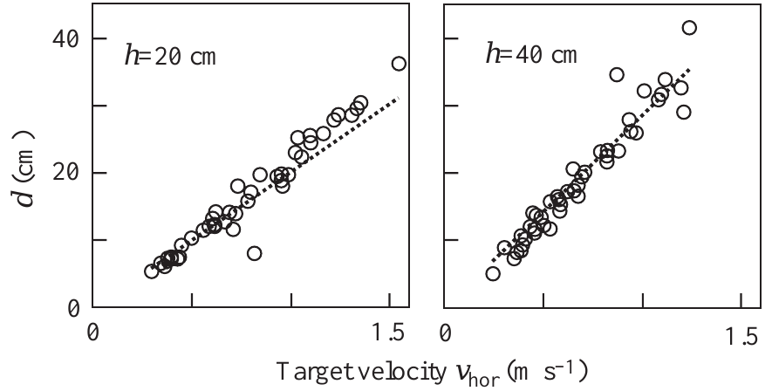
Initial height and velocity constrain the landing point
For the released flies, horizontal landing distance increased with initial horizontal velocity. Rossel and colleagues compared measured distances at 20- and 40-cm release heights with the ballistic predictions. The measured distances matched those predictions under these conditions, which means air resistance and initial vertical velocity contributed little to the trajectory.
The same horizontal speed produces a more distant landing point when the release height is greater, because the object stays airborne longer. A fish must therefore combine motion information with height information to locate the destination across both heights. The fish uses the release height and the horizontal speed together, so the response depends on both inputs at once.
The ballistic relation links the landing point to release height and initial horizontal velocity, the two variables that a fish needs to combine. Predicting the landing point from these two inputs allows the fish start its response before the prey reaches the water. Predicting the landing point from these two inputs allows the fish start its response before the prey reaches the water.
Rossel et al. (2002), Fig. 2. Landing distance versus horizontal take-off velocity at 20 and 40 cm.
Rossel et al. (2002)
04
Notes:
• For the released flies, horizontal landing distance increased with initial horizontal velocity. Rossel and colleagues compared the measured distances at 20- and 40-cm release heights with the published ballistic predictions. The data were consistent with negligible air resistance and negligible initial vertical velocity under these conditions.
– The published graph contains both measured landings and the authors’ theoretical curves. No values have been replotted or reconstructed.
• The same horizontal speed produces a more distant landing point when the release height is greater, because the object remains airborne longer. A fish must therefore combine motion information with height information; horizontal speed alone cannot identify the destination across both heights.
• The ballistic approximation was checked against actual prey paths rather than imposed without measurement. Under these conditions the landing point is fixed by release height and initial horizontal velocity, the two variables a fish needs to combine.
References:
Rossel S, Corlija J, Schuster S (2002). Predicting three-dimensional target motion: how archer fish determine where to catch their dislodged prey. Journal of Experimental Biology 205: 3321-3326. https://doi.org/10.1242/jeb.205.21.3321
Figure: Rossel et al. (2002), Fig. 2. Landing distance versus horizontal take-off velocity at 20 and 40 cm.
Figure source: https://doi.org/10.1242/jeb.205.21.3321

Slide 6
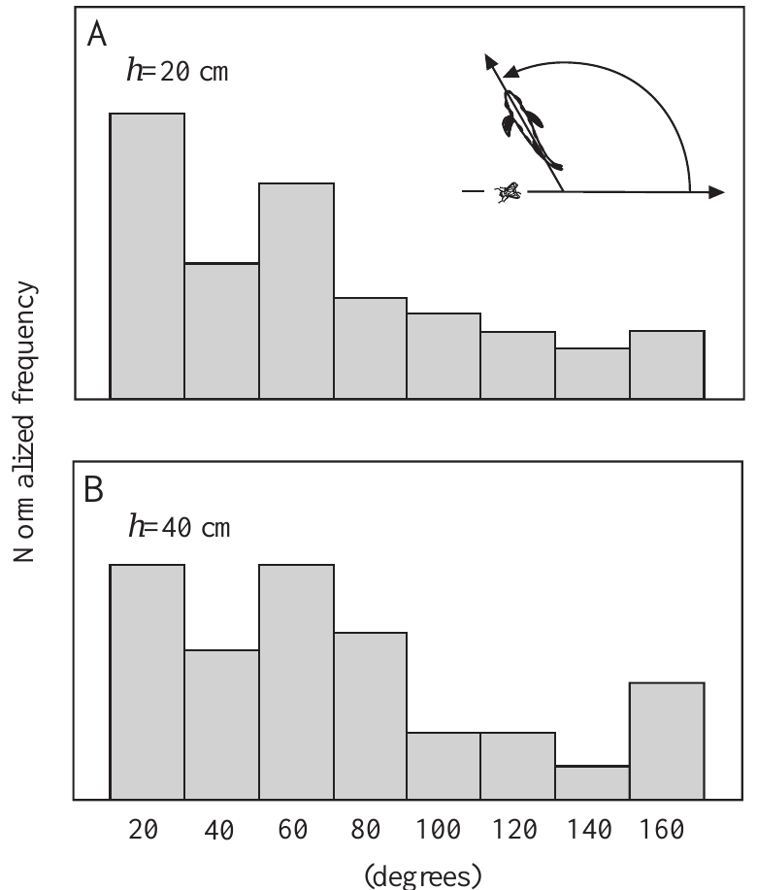
Interception works across widely different initial headings
A bystander’s initial orientation can differ greatly from the direction in which a dislodged fly moves. Rossel and colleagues sampled this angular relation at both 20- and 40-cm prey heights, including orientations that required large turns before acceleration toward the destination.
The observed headings were therefore not restricted to a shooter already facing the prey’s path. Responders could transform prey-motion information into a body-centered turning requirement while occupying different positions and orientations in the tank. Turning generally ended before the prey entered the water.
This behavioral flexibility rules out a fixed turn angle as an adequate explanation of interception. The turn must therefore depend on the angle between the current orientation of the fish and the direction of the predicted landing point.
Rossel et al. (2002), Fig. 3(A–B). Initial orientations sampled during prey interception.
Rossel et al. (2002)
05
Notes:
• A bystander’s initial orientation can differ greatly from the direction in which a dislodged fly moves. Rossel and colleagues sampled this angular relation at both 20- and 40-cm prey heights, including orientations that required large turns before acceleration toward the destination.
– The broad orientation distributions are separate from the later, higher-resolution measurements of C-start kinematics.
• The observed headings were therefore not restricted to a shooter already facing the prey’s path. Responders could transform prey-motion information into a body-centered turning requirement while occupying different positions and orientations in the tank. Turning generally ended before the prey entered the water.
• This behavioral flexibility rules out a fixed turn angle as an adequate explanation of interception. The turn must therefore depend on the angle between the current orientation of the fish and the direction of the predicted landing point.
References:
Rossel S, Corlija J, Schuster S (2002). Predicting three-dimensional target motion: how archer fish determine where to catch their dislodged prey. Journal of Experimental Biology 205: 3321-3326. https://doi.org/10.1242/jeb.205.21.3321
Figure: Rossel et al. (2002), Fig. 3(A–B). Initial orientations sampled during prey interception.
Figure source: https://doi.org/10.1242/jeb.205.21.3321

Slide 7
Heading is the direction of the body axis
Heading is the direction in which the body axis points at a given moment. A bystander's initial heading can differ greatly from the direction in which a dislodged fly moves, so the angle of the required turn changes from trial to trial.
Rossel and colleagues sampled this angular relation at both 20- and 40-cm prey heights, including orientations that required large turns before acceleration toward the destination. The fish occupied different positions and orientations in the tank, so the same destination was reached from many starting headings.
The turn needed to reach the destination depends on the heading at the moment of the response. A fixed turn angle would succeed from only one starting orientation, so the responder converts prey-motion information into a turn measured from its own body axis.
Rossel et al. (2002), Fig. 3(A–B). Initial orientations sampled during prey interception.
Rossel et al. (2002)
05a
Notes:
• Heading is the reference for measuring every turn in these experiments.
• Definition.
– Heading is the direction in which the body axis points.
– It is measured at the moment the response begins.
• Variation.
– A bystander can face almost any direction relative to the fly.
– The angle of the required turn therefore changes from trial to trial.
• Sampling.
– Rossel and colleagues sampled the angular relation at 20- and 40-cm prey heights.
– Some orientations required large turns before acceleration.
• Positions in the tank.
– Responders occupied different positions as well as different orientations.
– Turning generally ended before the prey entered the water.
• Body-centered turn.
– The fish must express the destination as a turn from its own body axis.
• Consequence for models.
– A fixed turn angle cannot explain interception.
– The responder must transform prey-motion information into a turn requirement.
• Links to the data.
– The angular relation was sampled at both prey heights.
– Orientations that needed large turns were included, which covers the range of initial headings.
References:
Rossel S, Corlija J, Schuster S (2002). Predicting three-dimensional target motion: how archer fish determine where to catch their dislodged prey. Journal of Experimental Biology 205: 3321-3326. https://doi.org/10.1242/jeb.205.21.3321

Slide 8
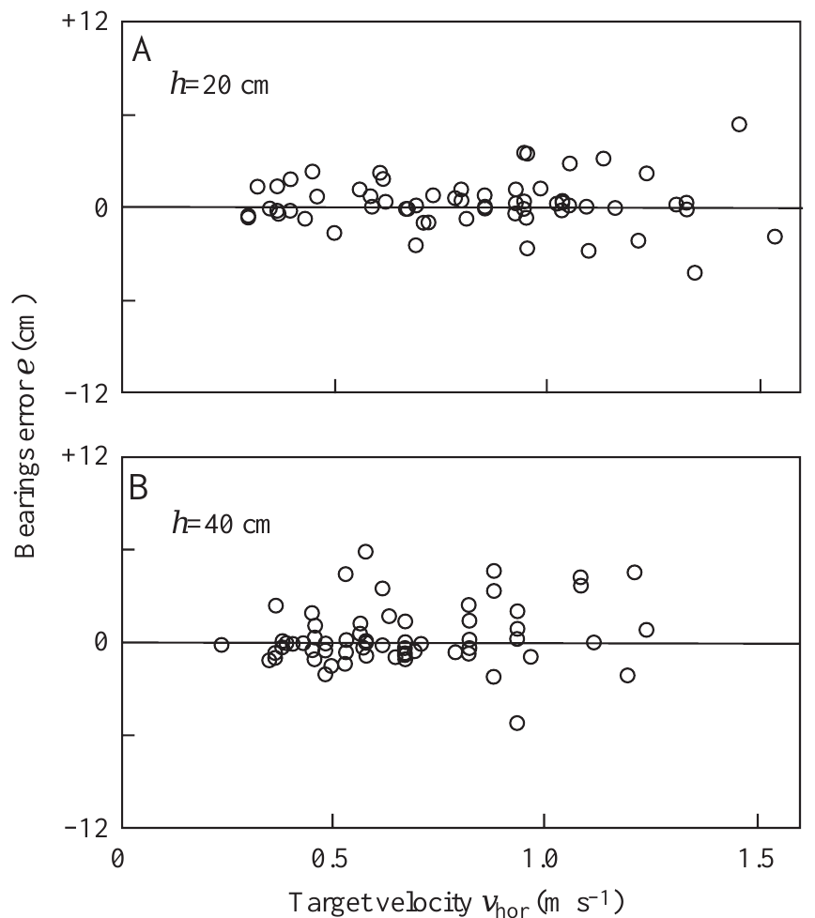
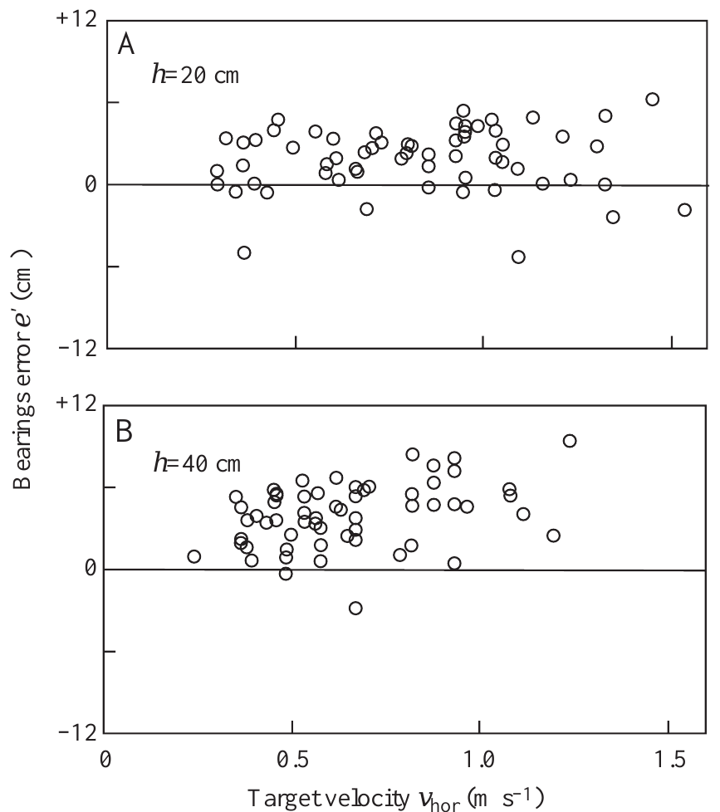
Turns target future impact rather than current prey position
Rossel and colleagues measured where the fish's final heading intersected the prey's projected horizontal path. Errors relative to the future water-entry point were centered near zero at both tested heights, across the naturally occurring range of horizontal take-off speeds, so the turns aimed at the point where the prey would enter the water.
Errors relative to the prey's position at turn completion showed a systematic offset instead. The fish had already aimed ahead of that position, so the response anticipates the landing point. This within-trial comparison used the same responses for both measures, so the offset reflects the aim itself. The offset appears in every trial of the test and shows the anticipation directly.
The result supports prediction of the landing destination before impact. The initial heading is set before later swimming corrections occur, so the initial aim itself carries the prediction. Aiming at the future water-entry point, and not at the current prey position, is the defining feature of a predictive start. The defining feature is the aim at the future entry point, so the prediction is expressed in the first heading the fish adopts.
Rossel et al. (2002), Fig. 5(A–B). Errors relative to the future landing point.
Rossel et al. (2002), Fig. 6(A–B). Errors relative to the prey position at turn completion.
Rossel et al. (2002)
06
Notes:
• Rossel and colleagues measured where the fish’s final heading intersected the prey’s projected horizontal path. Errors relative to the future water-entry point were centered near zero at both tested heights, across the naturally occurring range of horizontal take-off speeds.
– The two original error graphs use the same prey trajectories and turn responses, making the alternative aiming hypotheses directly comparable.
• Errors relative to the prey’s position at turn completion instead showed a systematic offset. The fish had already aimed ahead of that position. This within-trial comparison used the same responses and therefore did not confound two different groups of animals or two different stimulus histories.
• The result supports prediction of the landing destination before impact. It is stronger than merely observing that fish eventually catch prey, because later swimming corrections cannot account for the initial heading. Aiming at the future water-entry point and not at the current prey position is the defining feature of a predictive start.
References:
Rossel S, Corlija J, Schuster S (2002). Predicting three-dimensional target motion: how archer fish determine where to catch their dislodged prey. Journal of Experimental Biology 205: 3321-3326. https://doi.org/10.1242/jeb.205.21.3321
Figure: Rossel et al. (2002), Fig. 5(A–B). Errors relative to the future landing point.
Figure source: https://doi.org/10.1242/jeb.205.21.3321
Figure: Rossel et al. (2002), Fig. 6(A–B). Errors relative to the prey position at turn completion.
Figure source: https://doi.org/10.1242/jeb.205.21.3321

Slide 9
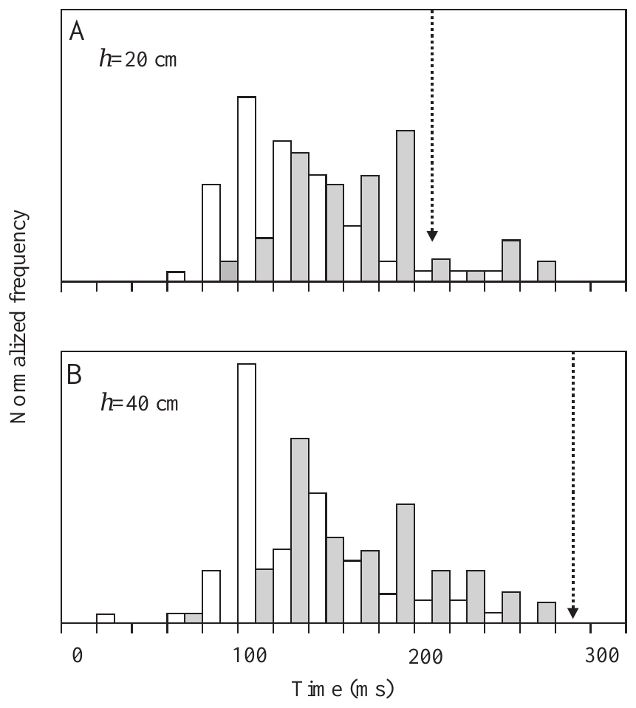
Reversing prey motion exposes an initial motor commitment
To test dependence on continuing visual feedback, Rossel and colleagues tethered prey with a thin filament. The fly initially moved freely for slightly more than 100 ms, then stopped and reversed its direction when the filament became taut.
Fish still turned and initially accelerated toward the landing point predicted from the early motion. Corrections appeared much later. An initial commitment therefore persisted even though the subsequently visible trajectory contradicted the motion information used to choose it.
This manipulation supports an initially programmed turn and acceleration rather than continuous tracking during that phase. The early motion therefore sets the turn and acceleration, and visual corrections enter only after the initial phase.
Rossel et al. (2002), Fig. 4(A–B). Turn onset and completion relative to prey landing.
Rossel et al. (2002)
07
Notes:
• To test dependence on continuing visual feedback, Rossel and colleagues tethered prey with a thin filament. The fly initially moved freely for slightly more than 100 ms, then stopped and reversed its direction when the filament became taut.
– The figure is the published free-flight latency distribution, not an invented reversal graph. The filament result is reported separately in the article text.
• Fish still turned and initially accelerated toward the landing point predicted from the early motion. Corrections appeared much later. An initial commitment therefore persisted even though the subsequently visible trajectory contradicted the motion information used to choose it.
• This manipulation supports an initially programmed turn and acceleration rather than continuous tracking during that phase. The early motion therefore sets the turn and acceleration, and visual corrections enter only after the initial phase.
References:
Rossel S, Corlija J, Schuster S (2002). Predicting three-dimensional target motion: how archer fish determine where to catch their dislodged prey. Journal of Experimental Biology 205: 3321-3326. https://doi.org/10.1242/jeb.205.21.3321
Figure: Rossel et al. (2002), Fig. 4(A–B). Turn onset and completion relative to prey landing.
Figure source: https://doi.org/10.1242/jeb.205.21.3321

Slide 10
Open-loop control runs without feedback
Open-loop control is a mode in which a movement is set in advance and runs without adjustment from feedback about its own outcome. Closed-loop control compares the outcome with the goal during the movement and corrects it.
Rossel and colleagues tethered prey with a thin filament. The fly moved freely for slightly more than 100 ms, then stopped and reversed when the filament became taut. Fish still turned and initially accelerated toward the landing point predicted from the early motion.
The initial turn and acceleration behaved as an open-loop command, because the contradicting trajectory did not alter them at once. Corrections appeared much afterward, so visual feedback acts on the response only after the initial phase.
Rossel et al. (2002), Fig. 4(A–B). Turn onset and completion relative to prey landing.
Rossel et al. (2002)
07a
Notes:
• The tether experiment separates a preset command from continuous tracking.
• Open loop.
– A movement runs as set in advance.
– Feedback about its outcome does not adjust it.
• Closed loop.
– The outcome is compared with the goal during the movement.
– Errors are corrected as they appear.
• The manipulation.
– Rossel and colleagues tethered prey with a thin filament.
– The fly moved freely for slightly more than 100 ms before the filament became taut.
• Prey behavior.
– The fly stopped and reversed its direction.
– The visible trajectory then contradicted the early motion.
• Fish response.
– Fish still turned and accelerated toward the landing point predicted from the early motion.
– Corrections appeared much afterward.
• Meaning.
– The first phase of the response was set by early motion information.
– Visual feedback adjusts the response only after the initial commitment.
• Timing.
– The early free motion lasted slightly more than 100 ms.
– The reversal therefore began after the fish had the information needed to choose a turn.
References:
Rossel S, Corlija J, Schuster S (2002). Predicting three-dimensional target motion: how archer fish determine where to catch their dislodged prey. Journal of Experimental Biology 205: 3321-3326. https://doi.org/10.1242/jeb.205.21.3321

Slide 11
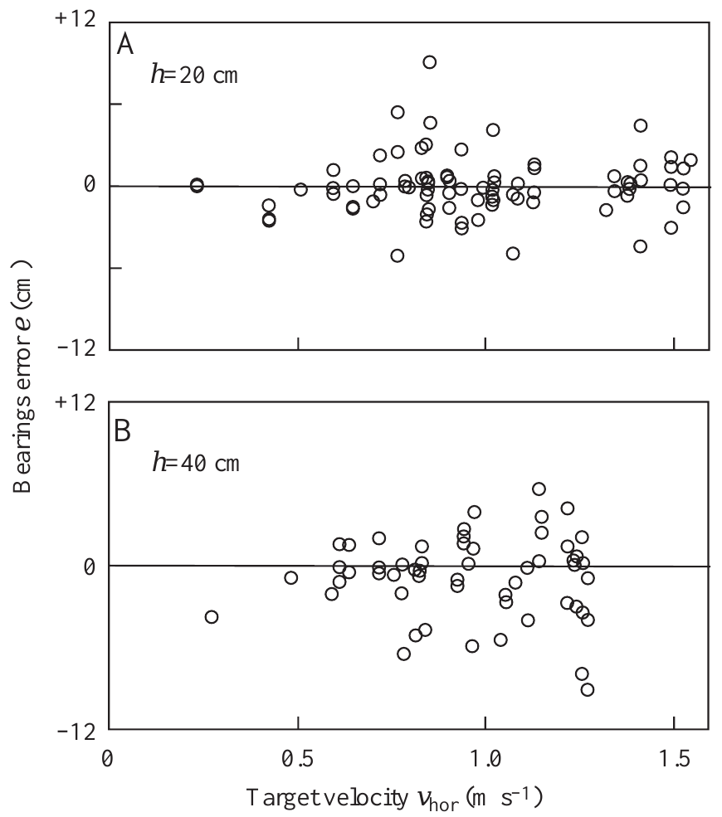
Horizontal motion evokes a virtual landing prediction
Rossel and colleagues placed prey on a transparent horizontal glass screen at 20 or 40 cm height. Air from a blast pipe moved the object horizontally at speeds within the natural take-off range. The target therefore moved without descending toward the water, so the fish saw horizontal motion with no fall.
Fish nevertheless turned toward the virtual landing point, the destination at which prey with that initial height and horizontal velocity would have entered the water if allowed to fall. Errors relative to this virtual point were centered near zero at both heights. The virtual landing point is a computed location rather than a visible one, so the response depends on the calculation.
The fish's turn therefore depends on a computed relation among initial height, speed and direction, rather than on the visible horizontal path alone. The horizontal screen supplies the speed and direction inputs without the fall, and the fish still outputs the landing point. The angle of the turn is computed from the prey's trajectory, so the response is specified by the calculation rather than by any visible target.
Rossel et al. (2002), Fig. 7(A–B). Turns toward virtual landing points for targets moving horizontally.
Rossel et al. (2002)
08
Notes:
• Rossel and colleagues placed prey on a transparent horizontal glass screen at 20 or 40 cm height. Air from a blast pipe moved the object horizontally at speeds within the natural take-off range. The target therefore moved without descending toward the water.
– Preventing descent changes the spatial trajectory while retaining the initial horizontal motion cue. That intervention separates trajectory continuation from a landing-point computation.
• Fish nevertheless turned toward the virtual landing point, the destination at which prey with that initial height and horizontal velocity would have entered the water if allowed to fall. Errors relative to this virtual point were centered near zero at both heights.
• Straight extrapolation of the actual horizontal trajectory cannot supply a finite water-entry point in this preparation. The result instead supports a relation built from initial height, speed and direction. The input to this relation is height, speed and direction, and the output is the landing point, so the horizontal screen supplies the inputs without the fall.
References:
Rossel S, Corlija J, Schuster S (2002). Predicting three-dimensional target motion: how archer fish determine where to catch their dislodged prey. Journal of Experimental Biology 205: 3321-3326. https://doi.org/10.1242/jeb.205.21.3321
Figure: Rossel et al. (2002), Fig. 7(A–B). Turns toward virtual landing points for targets moving horizontally.
Figure source: https://doi.org/10.1242/jeb.205.21.3321

Slide 12
A virtual landing point is defined by starting conditions
A virtual landing point is the destination at which prey with a given initial height and horizontal velocity would have entered the water if it had been allowed to fall. The experimenter defines it from the starting conditions, because the prey on the screen never descends.
Rossel and colleagues placed prey on a transparent horizontal glass screen at 20 or 40 cm height. Air from a blast pipe moved the object horizontally at speeds within the natural take-off range, so the target moved without descending toward the water.
Errors relative to the virtual point were centered near zero at both heights, so fish turned toward the destination that the motion would have produced. The response therefore depends on initial height, speed and direction, and not on a visible water-entry event.
Rossel et al. (2002), Fig. 7(A–B). Turns toward virtual landing points for targets moving horizontally.
Rossel et al. (2002)
08a
Notes:
• The virtual landing point allows the experimenter to test prediction without a fall.
• Definition.
– It is the destination where prey with a given height and horizontal velocity would have entered the water.
– The prey on the screen never reaches the water.
• The screen.
– Prey sat on a transparent horizontal glass screen at 20 or 40 cm height.
– Air from a blast pipe moved the object horizontally.
• Speeds.
– The speeds were within the natural take-off range.
– The target moved without descending toward the water.
• Fish response.
– Fish turned toward the virtual landing point.
– Errors relative to this point were centered near zero at both heights.
• Extrapolation.
– Straight extrapolation of the actual horizontal path gives no finite water-entry point.
– The fish must use another relation.
• Consequence.
– The relation is built from initial height, speed and direction.
– A visible water-entry event is not required.
• Controls the variables.
– Height was set at 20 or 40 cm.
– Horizontal speed was set by the air flow.
References:
Rossel S, Corlija J, Schuster S (2002). Predicting three-dimensional target motion: how archer fish determine where to catch their dislodged prey. Journal of Experimental Biology 205: 3321-3326. https://doi.org/10.1242/jeb.205.21.3321

Slide 13
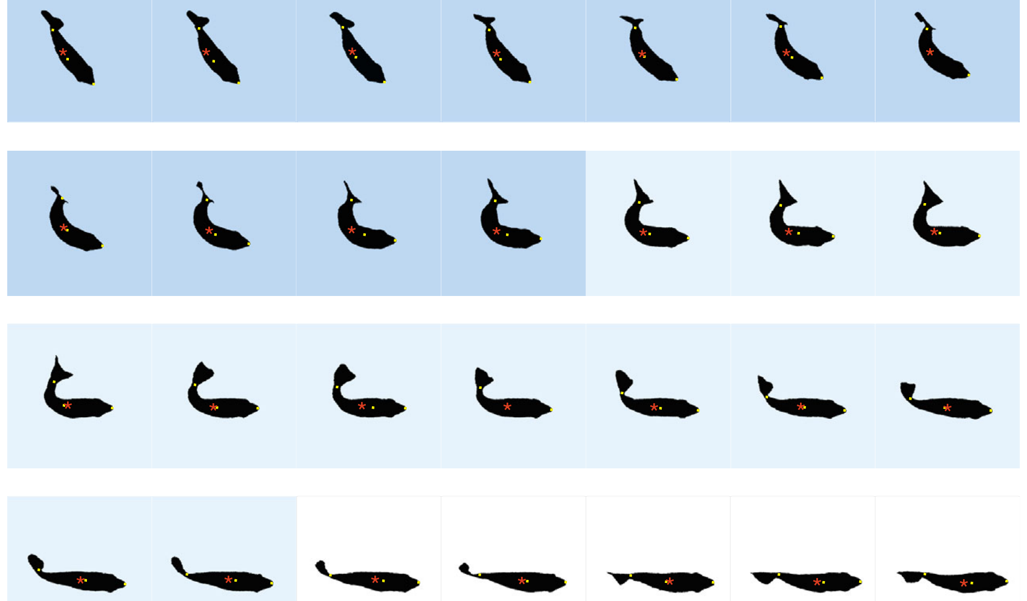
Predictive starts bend and then straighten the body
A C-start is a rapid maneuver in which the body first bends into a C-like shape and then straightens with an opposite tail movement. Wöhl and Schuster filmed predictive starts from above at 500 frames per second, resolving consecutive body positions every 2 ms.
They defined the first stage by bending toward the chosen destination and the second by straightening. In an original example, a fish rotated 43.6° within 22 ms and subsequently reached a take-off speed of 1.225 m/s. The center of mass and body axis were measured independently.
Thus, displacement and rotation are coordinated within a recognizable two-stage motor pattern. Stage one rotates the body toward the chosen destination, and stage two completes the turn while the fish accelerates.
Wöhl & Schuster (2007), Fig. 3. Original 2-ms silhouettes of bending, straightening and take-off.
Wöhl & Schuster (2007)
09
Notes:
• A C-start is a rapid maneuver in which the body first bends into a C-like shape and then straightens with an opposite tail movement. Wöhl and Schuster filmed predictive starts from above at 500 frames per second, resolving consecutive body positions every 2 ms.
– The silhouettes are the authors’ published high-speed sequence, including their stage colors and measured center-of-mass markers.
• They defined the first stage by bending toward the chosen destination and the second by straightening. In an original example, a fish rotated 43.6° within 22 ms and subsequently reached a take-off speed of 1.225 m/s. The center of mass and body axis were measured independently.
• Thus, displacement and rotation are coordinated within a recognizable two-stage motor pattern. Stage one rotates the body toward the chosen destination, and stage two completes the turn while the fish accelerates.
References:
Wöhl S, Schuster S (2007). The predictive start of hunting archer fish: a flexible and precise motor pattern performed with the kinematics of an escape C-start. Journal of Experimental Biology 210: 311-324. https://doi.org/10.1242/jeb.02646
Figure: Wöhl & Schuster (2007), Fig. 3. Original 2-ms silhouettes of bending, straightening and take-off.
Figure source: https://doi.org/10.1242/jeb.02646

Slide 14
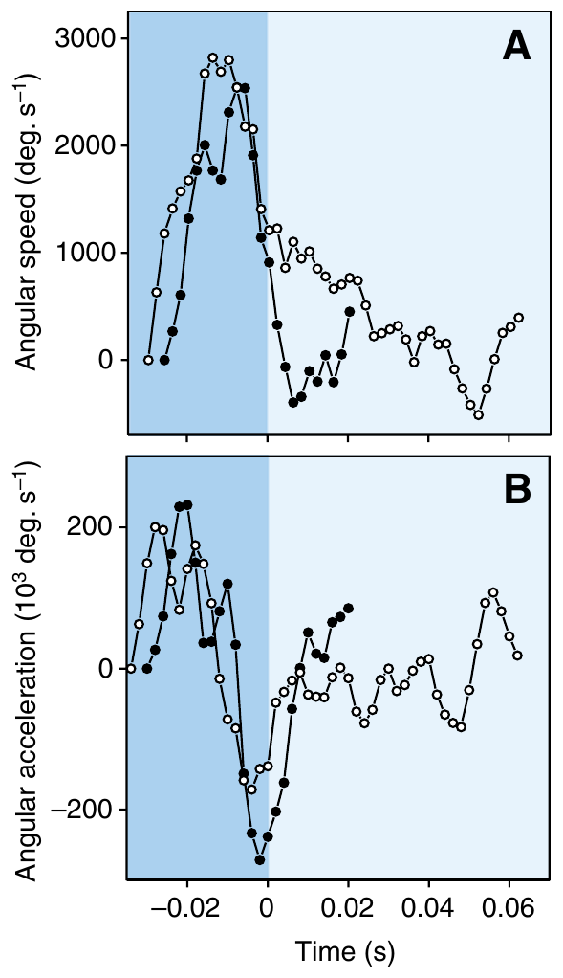
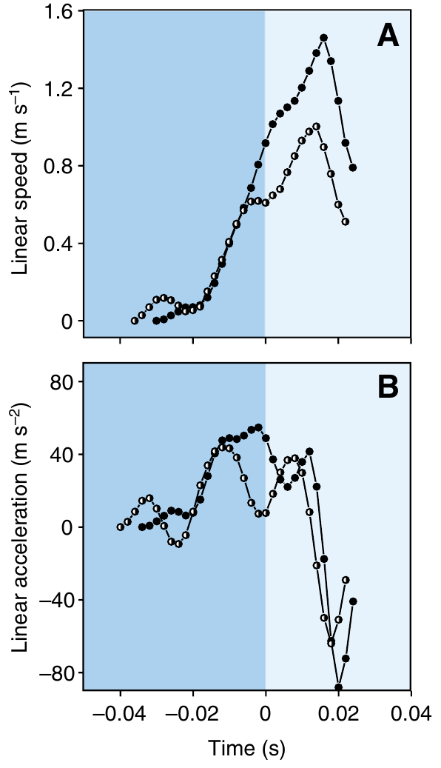
Fast starts combine rapid rotation with strong acceleration
Wöhl and Schuster reconstructed angular and linear motion from high-speed video. Predictive starts reached angular speeds above 4500°/s and linear speeds as high as 2.1 m/s. Their measured peak linear acceleration reached 120 m/s².
Angular speed generally peaked during initial bending, whereas the strongest linear speed occurred after straightening began. These different time courses separate reorientation from the subsequent acceleration toward the predicted prey destination. The same maneuver can therefore set both heading and take-off speed.
These are measured ranges across demanding interception responses, not a claim that every start achieves the maxima simultaneously. Peak values of 4500°/s and 2.1 m/s define the performance range that any controlling circuit must produce.
Wöhl & Schuster (2007), Fig. 5(A–B). Angular speed and acceleration during predictive starts.
Wöhl & Schuster (2007), Fig. 6(A–B). Linear speed and acceleration for different required take-off speeds.
Wöhl & Schuster (2007)
10
Notes:
• Wöhl and Schuster reconstructed angular and linear motion from high-speed video. Predictive starts reached angular speeds above 4500°/s and linear speeds as high as 2.1 m/s. Their measured peak linear acceleration reached 120 m/s².
– Angular speed measures change in body orientation per unit time; linear speed measures translation of the center of mass. The published profiles should not be treated as interchangeable.
• Angular speed generally peaked during initial bending, whereas the strongest linear speed occurred after straightening began. These different time courses separate reorientation from the subsequent acceleration toward the predicted prey destination. The same maneuver can therefore set both heading and take-off speed.
• These are measured ranges across demanding interception responses, not a claim that every start achieves the maxima simultaneously. Peak values of 4500°/s and 2.1 m/s define the performance range that any controlling circuit must produce.
References:
Wöhl S, Schuster S (2007). The predictive start of hunting archer fish: a flexible and precise motor pattern performed with the kinematics of an escape C-start. Journal of Experimental Biology 210: 311-324. https://doi.org/10.1242/jeb.02646
Figure: Wöhl & Schuster (2007), Fig. 5(A–B). Angular speed and acceleration during predictive starts.
Figure source: https://doi.org/10.1242/jeb.02646
Figure: Wöhl & Schuster (2007), Fig. 6(A–B). Linear speed and acceleration for different required take-off speeds.
Figure source: https://doi.org/10.1242/jeb.02646

Slide 15
Angular speed and linear speed measure different things
Angular speed is the rate at which the body axis rotates, expressed in degrees per second. Linear speed is the rate at which the center of mass moves through the water, in meters per second, and acceleration is the rate at which either speed changes.
Wöhl and Schuster reconstructed angular and linear motion from high-speed video. Predictive starts reached angular speeds above 4500°/s and linear speeds as high as 2.1 m/s, with peak linear acceleration reaching 120 m/s².
Angular speed generally peaked during initial bending, whereas the strongest linear speed occurred after straightening began. These different time courses separate reorientation from acceleration toward the predicted destination, so one maneuver sets both heading and take-off speed.
Wöhl & Schuster (2007), Fig. 5(A–B). Angular speed and acceleration during predictive starts.
Wöhl & Schuster (2007), Fig. 6(A–B). Linear speed and acceleration for different required take-off speeds.
Wöhl & Schuster (2007)
10a
Notes:
• Two kinds of speed describe the same fast start.
• Angular speed.
– It is the rate of rotation of the body axis in degrees per second.
– It measures how fast the fish turns.
• Linear speed.
– It is the rate at which the center of mass moves through the water.
– It measures how fast the fish travels toward the prey.
• Acceleration.
– Acceleration is the rate at which either speed changes.
– Peak linear acceleration reached 120 meters per second squared.
• Values.
– Angular speeds exceeded 4500 degrees per second.
– Linear speeds reached 2.1 meters per second.
• Timing.
– Angular speed generally peaked during initial bending.
– The strongest linear speed occurred after straightening began.
• Method.
– Wöhl and Schuster reconstructed the motion from high-speed video.
– Position records were smoothed before differentiation.
• Consequence.
– The same maneuver can set both heading and take-off speed.
• Peak acceleration.
– Peak linear acceleration reached 120 meters per second squared.
– The values come from demanding interception responses.
References:
Wöhl S, Schuster S (2007). The predictive start of hunting archer fish: a flexible and precise motor pattern performed with the kinematics of an escape C-start. Journal of Experimental Biology 210: 311-324. https://doi.org/10.1242/jeb.02646

Slide 16
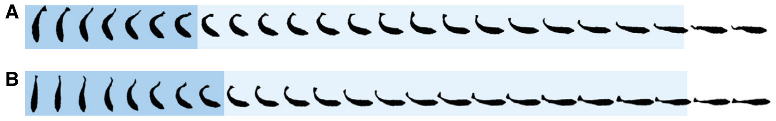
Predictive and escape starts share a fast motor pattern
Wöhl and Schuster elicited escape C-starts in the same fish and compared them with prey-directed predictive starts. Both behaviors contained rapid bending followed by straightening, and their ranges of stage durations and performance substantially overlapped.
Predictive starts were not systematically slower despite requiring a heading appropriate for a future catch point. Escape starts also varied in turn angle and speed, so neither behavioral category could be described adequately as a single stereotyped body movement.
The shared kinematics support possible recruitment of overlapping fast-start circuitry. The difference between the two behaviors lies in how the turn angle is chosen: away from a threat for an escape, toward a predicted catch point for a predictive start.
Wöhl & Schuster (2007), Fig. 12(A–B). Original comparison of predictive and escape C-start sequences.
Wöhl & Schuster (2007)
11
Notes:
• Wöhl and Schuster elicited escape C-starts in the same fish and compared them with prey-directed predictive starts. Both behaviors contained rapid bending followed by straightening, and their ranges of stage durations and performance substantially overlapped.
– The study compares actual predictive and experimentally elicited escape movements in the same preparation; circuit identity remains an inference from their similar performance.
• Predictive starts were not systematically slower despite requiring a heading appropriate for a future catch point. Escape starts also varied in turn angle and speed, so neither behavioral category could be described adequately as a single stereotyped body movement.
• The shared kinematics support possible recruitment of overlapping fast-start circuitry. The difference between the two behaviors lies in how the turn angle is chosen: away from a threat for an escape, toward a predicted catch point for a predictive start.
References:
Wöhl S, Schuster S (2007). The predictive start of hunting archer fish: a flexible and precise motor pattern performed with the kinematics of an escape C-start. Journal of Experimental Biology 210: 311-324. https://doi.org/10.1242/jeb.02646
Figure: Wöhl & Schuster (2007), Fig. 12(A–B). Original comparison of predictive and escape C-start sequences.
Figure source: https://doi.org/10.1242/jeb.02646

Slide 17
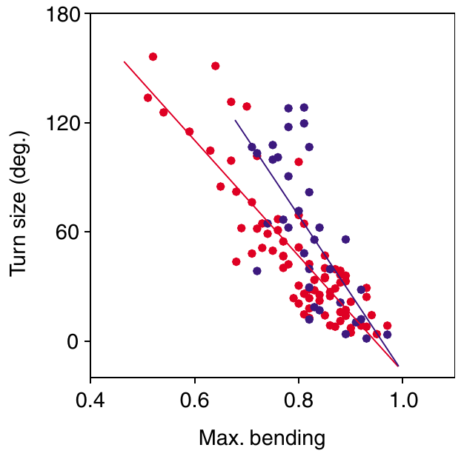
The amount of body bending helps set the turn angle
Predictive starts had to produce turns from 4° to 156° and take-off speeds from 0.4 to 2.1 m/s in Wöhl and Schuster’s recordings. Turn size was most closely associated with the maximum body bending reached at the end of the first stage.
For larger turns, further rotation could occur during straightening. Changes in stage durations, angular speed and displacement contributed additional variability. The motor pattern was therefore flexibly adjusted rather than selected from a small set of identical movements.
Turns from 4° to 156° are produced by scaling the first-stage bend, which gives the fish a continuous range of headings from one motor pattern. Any adequate mechanism must allow rapid movement with continuously variable turning and speed.
Wöhl & Schuster (2007), Fig. 9. Maximum bending predicts the required turn angle.
Wöhl & Schuster (2007)
12
Notes:
• Predictive starts had to produce turns from 4° to 156° and take-off speeds from 0.4 to 2.1 m/s in Wöhl and Schuster’s recordings. Turn size was most closely associated with the maximum body bending reached at the end of the first stage.
– The original relation compares required turn angle with the extent of bending. No graph has been generated from the reported angle range.
• For larger turns, further rotation could occur during straightening. Changes in stage durations, angular speed and displacement contributed additional variability. The motor pattern was therefore flexibly adjusted rather than selected from a small set of identical movements.
• Turns from 4° to 156° are produced by scaling the first-stage bend, which gives the fish a continuous range of headings from one motor pattern. Any adequate mechanism must allow rapid movement with continuously variable turning and speed.
References:
Wöhl S, Schuster S (2007). The predictive start of hunting archer fish: a flexible and precise motor pattern performed with the kinematics of an escape C-start. Journal of Experimental Biology 210: 311-324. https://doi.org/10.1242/jeb.02646
Figure: Wöhl & Schuster (2007), Fig. 9. Maximum bending predicts the required turn angle.
Figure source: https://doi.org/10.1242/jeb.02646

Slide 18
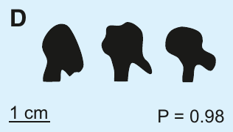
Target height changes jet control
Gerullis and Schuster trained Toxotes jaculatrix to shoot from a restricted channel at targets 20, 40 or 60 cm above the water. Small black spheres provided reproducible targets, and successful shots were rewarded with flies delivered in front of the shooter.
Side-view recordings reached 5000 frames per second, allowing the investigators to follow the water from emergence to impact. The fish tolerated the illumination needed for these recordings and maintained a nearly fixed mouth-tip position during water release.
This preparation separates the target’s range from the fish’s shooting position. The nearly fixed mouth-tip position means that changes in the jet reflect the control of the shot by the fish.
Gerullis & Schuster (2014), Fig. 1(D). Preimpact tips at 20, 40 and 60 cm; original 1-cm scale bar.
Gerullis & Schuster (2014)
13
Notes:
• Gerullis and Schuster trained Toxotes jaculatrix to shoot from a restricted channel at targets 20, 40 or 60 cm above the water. Small black spheres provided reproducible targets, and successful shots were rewarded with flies delivered in front of the shooter.
– Target spheres were 5 mm in diameter. The restricted channel reduced variation in position and camera angle across the three target heights.
• Side-view recordings reached 5000 frames per second, allowing the investigators to follow the water from emergence to impact. The fish tolerated the illumination needed for these recordings and maintained a nearly fixed mouth-tip position during water release.
• This preparation separates the target’s range from the fish’s shooting position. The nearly fixed mouth-tip position means that changes in the jet reflect the control of the shot by the fish.
References:
Gerullis P, Schuster S (2014). Archerfish Actively Control the Hydrodynamics of Their Jets. Current Biology 24: 2156-2160. https://doi.org/10.1016/j.cub.2014.07.059
Figure: Gerullis & Schuster (2014), Fig. 1(D). Preimpact tips at 20, 40 and 60 cm; original 1-cm scale bar.
Figure source: https://doi.org/10.1016/j.cub.2014.07.059

Slide 19
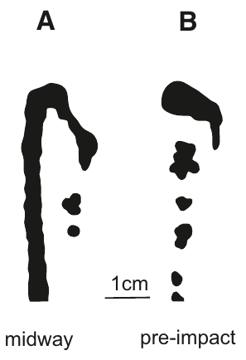
The jet focuses just before impact at the chosen range
In shots aimed at a target 60 cm high, the water had not finished assembling at the jet tip after 30 cm of travel. Near impact, the tip became concentrated. By contrast, a shot aimed at 20 cm was already focused at that closer target height.
Gerullis and Schuster compared original high-speed images at equivalent travel positions and at the preimpact phase. Preimpact tips were similarly concentrated across the three target heights, whereas the intermediate shapes differed according to the intended range.
The result rejects a fixed-distance focusing account in which water always assembles near the mouth and the finished tip simply travels onward. It supports active adjustment of the focusing distance. A fish aiming at 60 cm therefore completes focusing farther along the path than a fish aiming at 20 cm.
Gerullis & Schuster (2014), Fig. 1(A–B). A 60-cm shot midway through travel and just before impact.
Gerullis & Schuster (2014)
14
Notes:
• In shots aimed at a target 60 cm high, the water had not finished assembling at the jet tip after 30 cm of travel. Near impact, the tip became concentrated. By contrast, a shot aimed at 20 cm was already focused at that closer target height.
– The two photographs are different phases of a shot to the same 60-cm target, with the article’s original scale bar preserved.
• Gerullis and Schuster compared original high-speed images at equivalent travel positions and at the preimpact phase. Preimpact tips were similarly concentrated across the three target heights, whereas the intermediate shapes differed according to the intended range.
• The result rejects a fixed-distance focusing account in which water always assembles near the mouth and the finished tip simply travels onward. It supports active adjustment of the focusing distance. A fish aiming at 60 cm therefore completes focusing farther along the path than a fish aiming at 20 cm.
References:
Gerullis P, Schuster S (2014). Archerfish Actively Control the Hydrodynamics of Their Jets. Current Biology 24: 2156-2160. https://doi.org/10.1016/j.cub.2014.07.059
Figure: Gerullis & Schuster (2014), Fig. 1(A–B). A 60-cm shot midway through travel and just before impact.
Figure source: https://doi.org/10.1016/j.cub.2014.07.059

Slide 20
A focused jet gathers water into a compact tip
A focused jet is one in which the water has gathered into a concentrated tip, so that the water arrives at the target as a compact mass. The focusing distance is the distance along the path at which the water finishes gathering.
In shots aimed at a target 60 cm high, the water had not finished assembling at the jet tip after 30 cm of travel, and near impact the tip became concentrated. A shot aimed at 20 cm was already focused at that closer target height.
Preimpact tips were similarly concentrated across the three target heights, whereas intermediate shapes differed with the intended range. The focusing distance is therefore adjusted to the distance of the target and is not fixed near the mouth.
Gerullis & Schuster (2014), Fig. 1(A–B). A 60-cm shot midway through travel and just before impact.
Gerullis & Schuster (2014)
14a
Notes:
• Focusing describes how the water of a shot is arranged as it travels.
• Definition.
– A focused jet has gathered its water into a concentrated tip.
– The focusing distance is where this gathering finishes.
• Long-range shot.
– For a target 60 cm high, the water had not finished assembling after 30 cm.
– The tip became concentrated near impact.
• Short-range shot.
– A shot aimed at 20 cm was already focused at that closer height.
• Image comparison.
– Gerullis and Schuster compared original high-speed images at equivalent travel positions.
– They also compared the preimpact phase.
• Preimpact tips.
– They were similarly concentrated across the three target heights.
– Intermediate shapes differed with the intended range.
• Consequence.
– A fixed-distance account would have the water assemble near the mouth.
– The data instead show that focusing distance follows the target distance.
• Comparison of heights.
– The 20 cm shot and the 60 cm shot differ in where the tip finishes forming.
– The impact shape is similar in both.
References:
Gerullis P, Schuster S (2014). Archerfish Actively Control the Hydrodynamics of Their Jets. Current Biology 24: 2156-2160. https://doi.org/10.1016/j.cub.2014.07.059

Slide 21
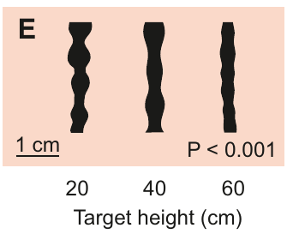
Jet stability also depends on intended target distance
A water jet can develop diameter fluctuations and break into droplets. Gerullis and Schuster inspected the jet shaft after a common 30-cm path, comparing shots originally directed toward different target heights. Longer-range jets had fewer shaft modulations than shorter-range jets.
For close targets, rare missed shots allowed observation beyond the intended impact point without collision with the target. This control matters because a jet that struck a target could break up as a consequence of the collision rather than its original hydrodynamic design.
The resulting differences support coordinated control of stability and focusing range. Longer-range shots need a jet that stays intact over a greater distance, and the reduced shaft modulation fits that requirement.
Gerullis & Schuster (2014), Fig. 1(E). Shaft stability after a common 30-cm path.
Gerullis & Schuster (2014)
15
Notes:
• A water jet can develop diameter fluctuations and break into droplets. Gerullis and Schuster inspected the jet shaft after a common 30-cm path, comparing shots originally directed toward different target heights. Longer-range jets had fewer shaft modulations than shorter-range jets.
– The published comparison preserves a common travel distance. Missed short-range targets supplied the required uninterrupted jets for that comparison.
• For close targets, rare missed shots allowed observation beyond the intended impact point without collision with the target. This control matters because a jet that struck a target could break up as a consequence of the collision rather than its original hydrodynamic design.
• The resulting differences support coordinated control of stability and focusing range. Longer-range shots need a jet that stays intact over a greater distance, and the reduced shaft modulation fits that requirement.
References:
Gerullis P, Schuster S (2014). Archerfish Actively Control the Hydrodynamics of Their Jets. Current Biology 24: 2156-2160. https://doi.org/10.1016/j.cub.2014.07.059
Figure: Gerullis & Schuster (2014), Fig. 1(E). Shaft stability after a common 30-cm path.
Figure source: https://doi.org/10.1016/j.cub.2014.07.059

Slide 22
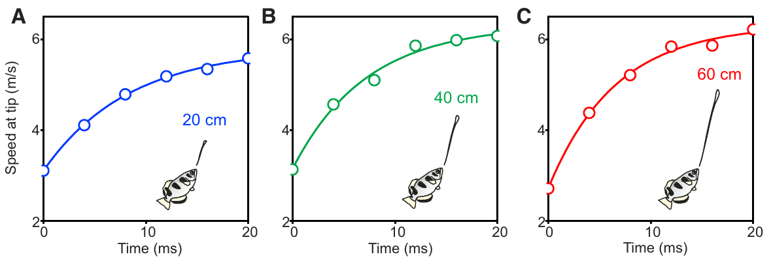
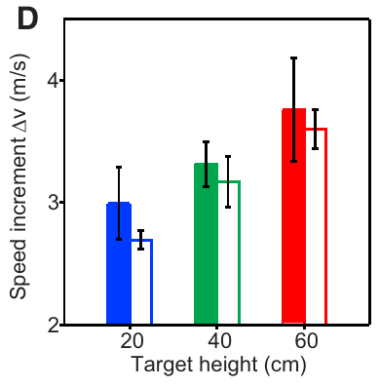
Later-emerging water accelerates the jet tip
Gerullis and Schuster measured the tip speed during the first 20 ms of jet formation. The tip accelerated even while the jet rose against gravity, because it remained connected to subsequently emitted water moving faster than the early water.
Published fits yielded hypothetical limiting speeds of 5.8–6.8 m/s, total speed increments of 2.7–3.8 m/s, and time constants of 6.6–20.0 ms. The speed increment increased with target height, linking the early-to-late velocity difference to the intended shooting range.
The data support adjustable velocity gradients and reject an ordinary rigid-projectile description of the jet. Faster water emitted behind slower water catches the tip, which is how a velocity gradient gathers the water toward the impact point.
Gerullis & Schuster (2014), Fig. 2(A–C). Tip acceleration during the first 20 ms at three target heights.
Gerullis & Schuster (2014), Fig. 2(D). Speed increment increases with target height.
Gerullis & Schuster (2014)
16
Notes:
• Gerullis and Schuster measured the tip speed during the first 20 ms of jet formation. The tip accelerated even while the jet rose against gravity, because it remained connected to subsequently emitted water moving faster than the early water.
– The curves are the original published fits and data. The slides describe their parameters without calculating or drawing a new jet model.
• Published fits yielded hypothetical limiting speeds of 5.8–6.8 m/s, total speed increments of 2.7–3.8 m/s, and time constants of 6.6–20.0 ms. The speed increment increased with target height, linking the early-to-late velocity difference to the intended shooting range.
• The data support adjustable velocity gradients and reject an ordinary rigid-projectile description of the jet. Faster water emitted behind slower water catches the tip, which is how a velocity gradient gathers the water toward the impact point.
References:
Gerullis P, Schuster S (2014). Archerfish Actively Control the Hydrodynamics of Their Jets. Current Biology 24: 2156-2160. https://doi.org/10.1016/j.cub.2014.07.059
Figure: Gerullis & Schuster (2014), Fig. 2(A–C). Tip acceleration during the first 20 ms at three target heights.
Figure source: https://doi.org/10.1016/j.cub.2014.07.059
Figure: Gerullis & Schuster (2014), Fig. 2(D). Speed increment increases with target height.
Figure source: https://doi.org/10.1016/j.cub.2014.07.059

Slide 23
A velocity gradient speeds rear water catch the tip
A velocity gradient is a difference in speed between parts of the same moving body of water, here between the water emitted first at the front and the water emitted behind it. Faster rear water can catch up with slower front water.
Gerullis and Schuster measured the tip speed during the first 20 ms of jet formation. The tip accelerated even while the jet rose against gravity, because it remained connected to subsequently emitted water moving faster than the early water.
Published fits gave total speed increments of 2.7–3.8 m/s, and the increment increased with target height. A larger difference between early and subsequent water therefore belongs to a longer intended range, unlike an ordinary rigid projectile.
Gerullis & Schuster (2014), Fig. 2(A–C). Tip acceleration during the first 20 ms at three target heights.
Gerullis & Schuster (2014), Fig. 2(D). Speed increment increases with target height.
Gerullis & Schuster (2014)
16a
Notes:
• The jet is a stream of water emitted over time, and its speed varies along its length.
• Definition.
– A velocity gradient is a difference in speed along the moving water.
– Here the rear water moves faster than the front water.
• Tip acceleration.
– The tip accelerated during the first 20 ms of formation.
– It did so even while the jet rose against gravity.
• Cause.
– The tip stayed connected to subsequently emitted water.
– That water moved faster than the early water.
• Fitted values.
– Limiting speeds were 5.8–6.8 meters per second.
– Total speed increments were 2.7–3.8 meters per second.
• Time constants.
– Fitted time constants ranged from 6.6 to 20.0 ms.
• Range dependence.
– The speed increment increased with target height.
– A longer range is linked to a larger early-to-late velocity difference.
• Contrast.
– An ordinary rigid projectile does not have such a gradient.
• Link to the mouth.
– The velocity difference between early and subsequent water depends on how the mouth releases the water.
– The gradient is therefore a product of the control of the shot by the fish.
References:
Gerullis P, Schuster S (2014). Archerfish Actively Control the Hydrodynamics of Their Jets. Current Biology 24: 2156-2160. https://doi.org/10.1016/j.cub.2014.07.059

Slide 24
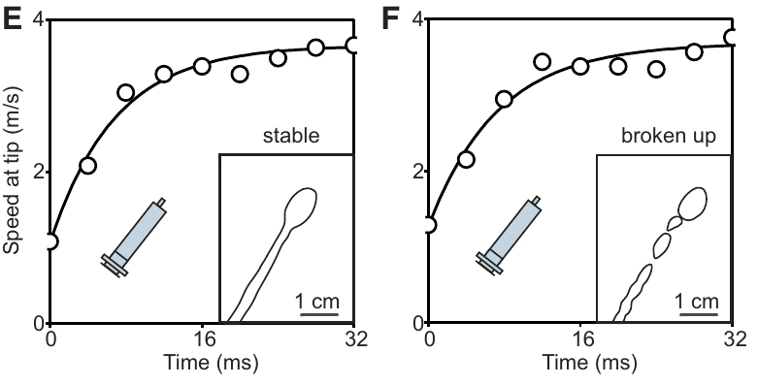
A matching speed profile does not guarantee a stable jet
To test whether tip acceleration alone explains coherence, Gerullis and Schuster produced upward jets with a fixed disposable syringe. High-speed recordings captured both jets that remained coherent during release and jets that broke up before all the water had emerged.
The two classes nevertheless had similar fitted tip-speed time courses. The apparatus could therefore reproduce the increase in speed without consistently reproducing the stability of an archerfish shot. This control separates a sufficient description of tip motion from a sufficient mechanism for the whole jet.
A living fish must coordinate properties beyond the acceleration profile if it maintains stable, focused impacts over different ranges. Stable jets therefore depend on additional controlled variables, such as the timing of water release at the mouth.
Gerullis & Schuster (2014), Fig. 2(E–F). Stable and unstable syringe jets with similar tip-speed profiles.
Gerullis & Schuster (2014)
17
Notes:
• To test whether tip acceleration alone explains coherence, Gerullis and Schuster produced upward jets with a fixed disposable syringe. High-speed recordings captured both jets that remained coherent during release and jets that broke up before all the water had emerged.
– Stable and broken syringe jets are original experimental controls in the paper. Their similar speed fits do not establish that the syringe duplicates every biological flow variable.
• The two classes nevertheless had similar fitted tip-speed time courses. The apparatus could therefore reproduce the increase in speed without consistently reproducing the stability of an archerfish shot. This control separates a sufficient description of tip motion from a sufficient mechanism for the whole jet.
• A living fish must coordinate properties beyond the acceleration profile if it maintains stable, focused impacts over different ranges. Stable jets therefore depend on additional controlled variables, such as the timing of water release at the mouth.
References:
Gerullis P, Schuster S (2014). Archerfish Actively Control the Hydrodynamics of Their Jets. Current Biology 24: 2156-2160. https://doi.org/10.1016/j.cub.2014.07.059
Figure: Gerullis & Schuster (2014), Fig. 2(E–F). Stable and unstable syringe jets with similar tip-speed profiles.
Figure source: https://doi.org/10.1016/j.cub.2014.07.059

Slide 25
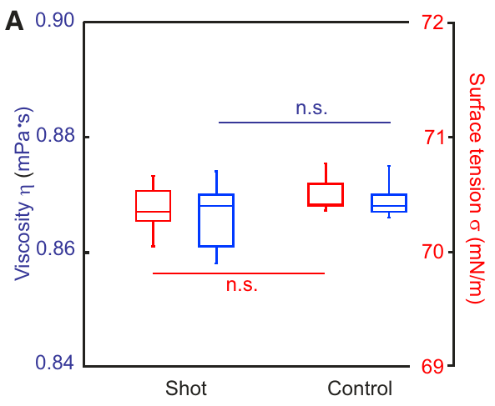
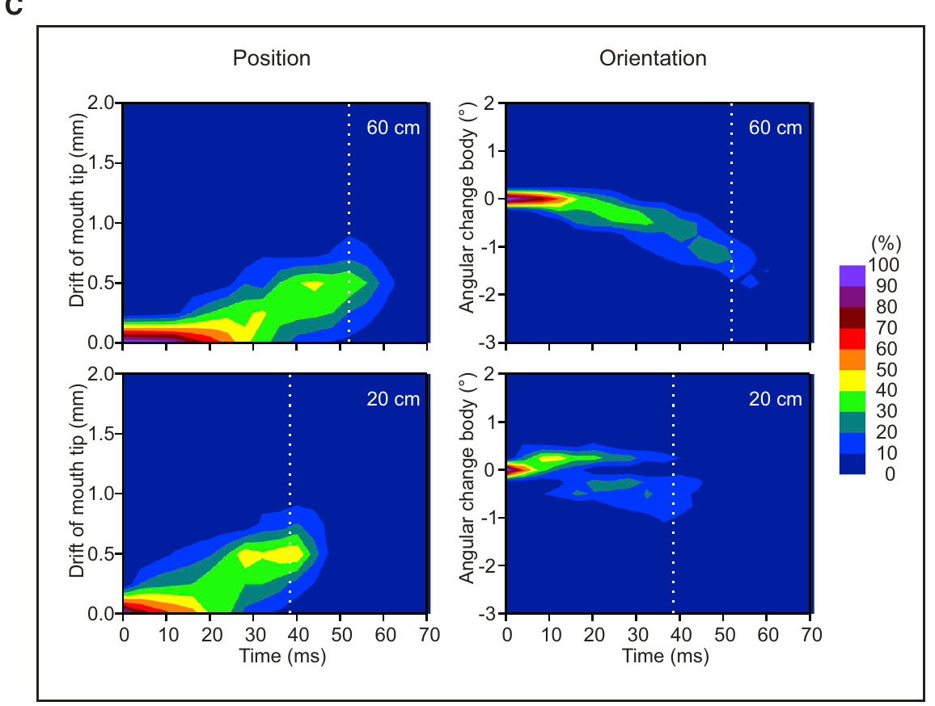
Shot chemistry and body drift do not explain range tuning
Gerullis and Schuster collected water fired by the fish and compared it with control water. Shot viscosity was 0.867 mPa·s and control viscosity 0.869 mPa·s; surface tension was 70.37 versus 70.49 mN/m. No detectable change in these properties supported chemical tuning of the fluid.
They also tracked mouth-tip displacement and body orientation during emission. Average total displacement was below 0.26 mm and total rotation below 0.5°, with no systematic dependence on target height. Range tuning therefore could not be attributed to large body movements during the shot.
Fluid properties identical to control water and displacement below 0.26 mm point to the time-varying mouth opening as the adjustable element. Water composition and whole-body motion do not supply the range adjustment.
Gerullis & Schuster (2014), Fig. 3(A). Water-shot viscosity and surface tension compared with controls.
Gerullis & Schuster (2014), Fig. 3(C). Mouth-tip drift and body rotation during water release.
Gerullis & Schuster (2014)
18
Notes:
• Gerullis and Schuster collected water fired by the fish and compared it with control water. Shot viscosity was 0.867 mPa·s and control viscosity 0.869 mPa·s; surface tension was 70.37 versus 70.49 mN/m. No detectable change in these properties supported chemical tuning of the fluid.
– Viscosity measures resistance to shear and surface tension measures the energetic cost of the water–air interface. The measured shot water retained the tested properties of ordinary control water.
• They also tracked mouth-tip displacement and body orientation during emission. Average total displacement was below 0.26 mm and total rotation below 0.5°, with no systematic dependence on target height. Range tuning therefore could not be attributed to large body movements during the shot.
• Fluid properties identical to control water and displacement below 0.26 mm point to the time-varying mouth opening as the adjustable element. Water composition and whole-body motion do not supply the range adjustment.
References:
Gerullis P, Schuster S (2014). Archerfish Actively Control the Hydrodynamics of Their Jets. Current Biology 24: 2156-2160. https://doi.org/10.1016/j.cub.2014.07.059
Figure: Gerullis & Schuster (2014), Fig. 3(A). Water-shot viscosity and surface tension compared with controls.
Figure source: https://doi.org/10.1016/j.cub.2014.07.059
Figure: Gerullis & Schuster (2014), Fig. 3(C). Mouth-tip drift and body rotation during water release.
Figure source: https://doi.org/10.1016/j.cub.2014.07.059

Slide 26
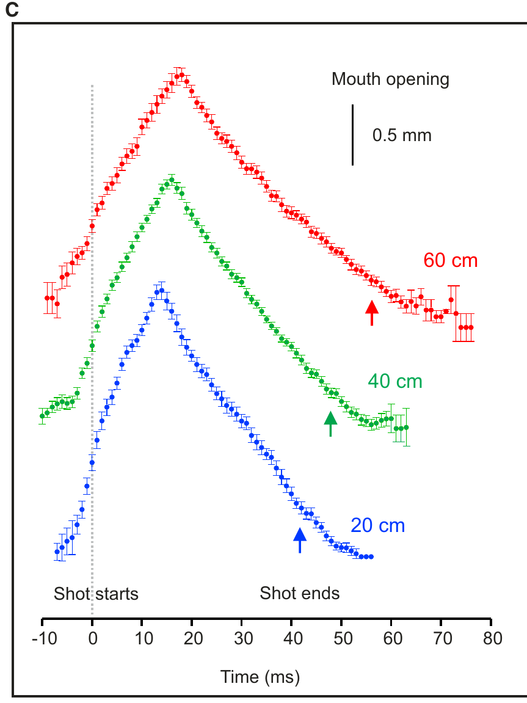
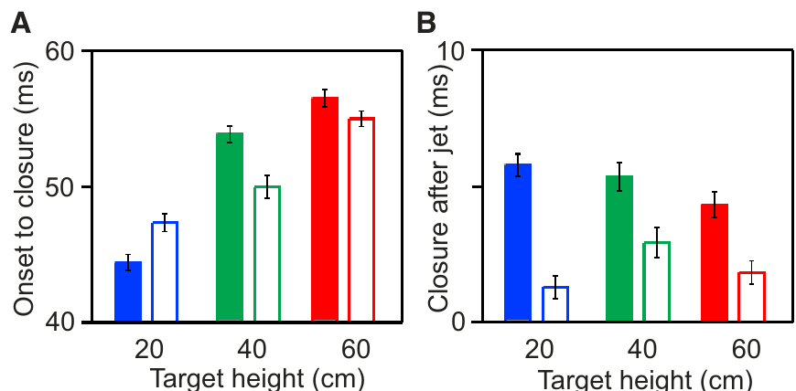
Mouth-opening dynamics tune the duration of water release
The mouth opening changed continuously during a shot; it did not form a constant aperture that simply opened and shut. Gerullis and Schuster measured opening and closing at 20-, 40- and 60-cm target heights, aligning records to the onset of water emergence.
The onset-to-closure interval increased with range, approximately 3.4 ms per additional 10 cm in the authors’ analysis. Maximum opening width and the final closure interval after release were comparatively unchanged. Specific phases of the movement therefore changed independently rather than undergoing uniform slowing.
This pattern supports active control of a time-dependent outlet to coordinate jet formation and range. Releasing water for a longer interval supplies the faster subsequent water that long-range jets require.
Gerullis & Schuster (2014), Fig. 4(C). Mouth-opening time courses for three target heights.
Gerullis & Schuster (2014), Fig. 4(A–B). Range-dependent onset-to-closure time and final closure after the jet.
Gerullis & Schuster (2014)
19
Notes:
• The mouth opening changed continuously during a shot; it did not form a constant aperture that simply opened and shut. Gerullis and Schuster measured opening and closing at 20-, 40- and 60-cm target heights, aligning records to the onset of water emergence.
– An aperture is the opening through which water exits. The invariant maximum width separates timing adjustments from a simple increase in mouth-opening size.
• The onset-to-closure interval increased with range, approximately 3.4 ms per additional 10 cm in the authors’ analysis. Maximum opening width and the final closure interval after release were comparatively unchanged. Specific phases of the movement therefore changed independently rather than undergoing uniform slowing.
• This pattern supports active control of a time-dependent outlet to coordinate jet formation and range. Releasing water for a longer interval supplies the faster subsequent water that long-range jets require.
References:
Gerullis P, Schuster S (2014). Archerfish Actively Control the Hydrodynamics of Their Jets. Current Biology 24: 2156-2160. https://doi.org/10.1016/j.cub.2014.07.059
Figure: Gerullis & Schuster (2014), Fig. 4(C). Mouth-opening time courses for three target heights.
Figure source: https://doi.org/10.1016/j.cub.2014.07.059
Figure: Gerullis & Schuster (2014), Fig. 4(A–B). Range-dependent onset-to-closure time and final closure after the jet.
Figure source: https://doi.org/10.1016/j.cub.2014.07.059

Slide 27
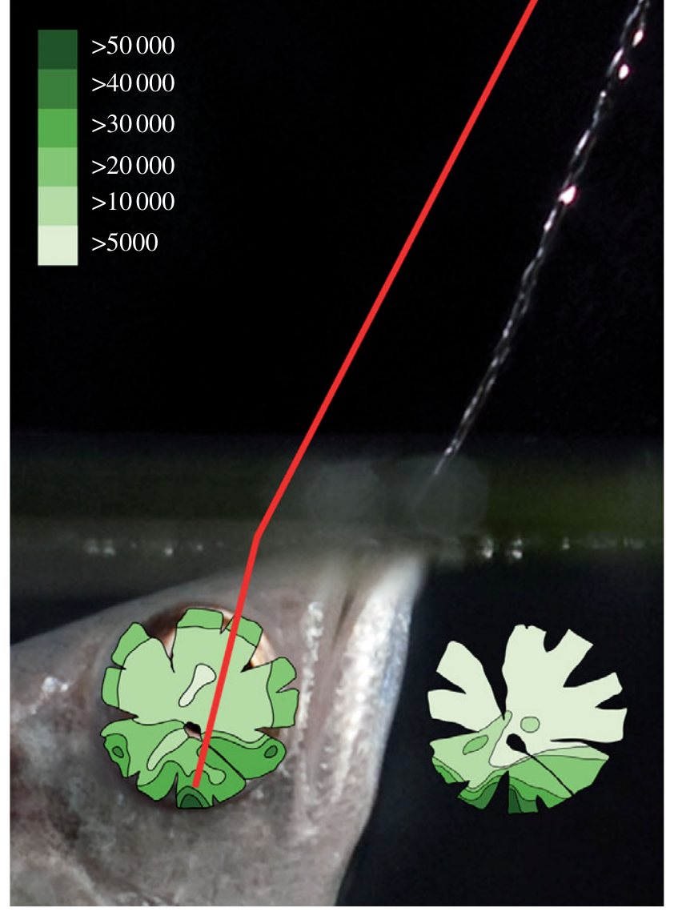
A retinal high-density region aligns with aerial aiming
Temple and colleagues mapped cones and retinal ganglion cells in Toxotes chatareus using retinal preparations and anatomical counts. A ventral high-density region aligned with the up-forward visual direction used during spitting, rather than providing equal sampling across the entire visual field.
The highest cone densities exceeded 50,000 cells/mm², and the local ganglion-cell density approached a one-to-one relation with cone density in that region. Anatomically estimated resolving power reached 6.9 cycles/degree there, compared with 2.2 cycles/degree along the downward visual axis.
A cycle is one bright–dark repetition in a spatial pattern; more cycles per degree indicate finer anatomical sampling. These estimates connect retinal organization to the preferred shooting direction. The up-forward region therefore provides the finest anatomical sampling along the direction in which the fish aims.
Temple et al. (2010), Fig. 3. Ganglion-cell topography aligned with the preferred shooting axis.
Temple et al. (2010)
20
Notes:
• Temple and colleagues mapped cones and retinal ganglion cells in Toxotes chatareus using retinal preparations and anatomical counts. A ventral high-density region aligned with the up-forward visual direction used during spitting, rather than providing equal sampling across the entire visual field.
– Cone photoreceptors sample incident light, whereas ganglion cells form the retina’s output population. The anatomical estimate depends on cell spacing and optical geometry.
• The highest cone densities exceeded 50,000 cells/mm², and the local ganglion-cell density approached a one-to-one relation with cone density in that region. Anatomically estimated resolving power reached 6.9 cycles/degree there, compared with 2.2 cycles/degree along the downward visual axis.
• A cycle is one bright–dark repetition in a spatial pattern; more cycles per degree indicate finer anatomical sampling. These estimates connect retinal organization to the preferred shooting direction. The up-forward region therefore provides the finest anatomical sampling along the direction in which the fish aims.
References:
Temple S, Hart NS, Marshall NJ, Collin SP (2010). A spitting image: specializations in archerfish eyes for vision at the interface between air and water. Proceedings of the Royal Society B: Biological Sciences 277: 2607-2615. https://doi.org/10.1098/rspb.2010.0345
Figure: Temple et al. (2010), Fig. 3. Ganglion-cell topography aligned with the preferred shooting axis.
Figure source: https://doi.org/10.1098/rspb.2010.0345

Slide 28
Resolving power is the finest detail an eye can sample
Resolving power is the finest spatial detail an eye can distinguish, expressed in cycles per degree. A cycle is one bright–dark repetition in a spatial pattern, and more cycles per degree indicate finer sampling by cones and ganglion cells.
Temple and colleagues mapped cones and retinal ganglion cells in Toxotes chatareus. The highest cone densities exceeded 50,000 cells/mm², and ganglion-cell density approached a one-to-one relation with cone density there. Anatomically estimated resolving power reached 6.9 cycles/degree, compared with 2.2 cycles/degree along the downward axis.
A ventral high-density region aligns with the up-forward visual direction used during spitting. Sampling is therefore finest where the fish aims and coarser elsewhere, instead of equal across the entire visual field.
Temple et al. (2010), Fig. 3. Ganglion-cell topography aligned with the preferred shooting axis.
Temple et al. (2010)
20a
Notes:
• Resolving power links retinal anatomy to the direction of aiming.
• Definition.
– Resolving power is the finest spatial detail an eye can distinguish.
– It is expressed in cycles per degree.
• Cycle.
– A cycle is one bright–dark repetition in a spatial pattern.
– More cycles per degree mean finer sampling.
• Cone density.
– The highest cone densities exceeded 50,000 cells per square millimeter.
– Ganglion-cell density approached a one-to-one relation with cone density there.
• Estimates.
– Resolving power reached 6.9 cycles per degree in the ventral region.
– It was 2.2 cycles per degree along the downward visual axis.
• Alignment.
– The high-density region faces the up-forward direction used during spitting.
• Methods.
– Temple and colleagues used retinal preparations and anatomical counts in Toxotes chatareus.
• Consequence.
– The retina samples most finely along the aiming direction instead of equally across the field.
• Directions in the visual field.
– The up-forward direction is the one used during spitting.
– The downward axis has lower resolving power.
References:
Temple S, Hart NS, Marshall NJ, Collin SP (2010). A spitting image: specializations in archerfish eyes for vision at the interface between air and water. Proceedings of the Royal Society B: Biological Sciences 277: 2607-2615. https://doi.org/10.1098/rspb.2010.0345

Slide 29
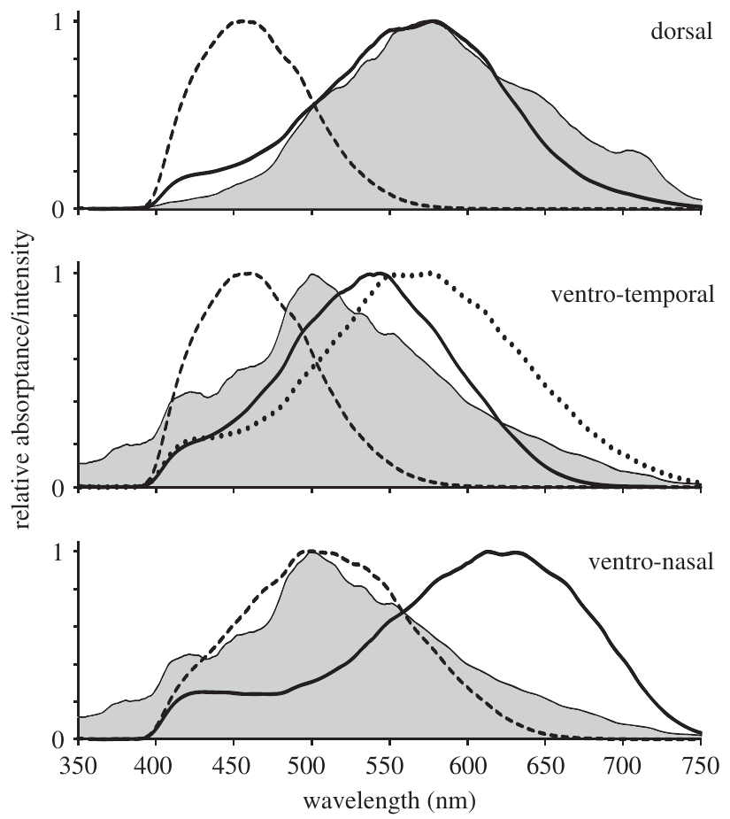
Cone spectral sensitivity differs across retinal regions
Temple and colleagues used microspectrophotometry to measure absorption in individual photoreceptors, then corrected absorptance for ocular transmission and photopigment properties. Their comparisons separated retinal regions viewing different parts of the aquatic and aerial environment.
The published spectra contain short-, middle- and long-wavelength cone contributions and show regional differences in their combined spectral coverage. The measurements directly concern light capture by the receptors; they are not inferred solely from a fish choosing among colored targets.
A photopigment is a light-absorbing receptor molecule that initiates a photoreceptor response. Regional sensitivity can shape which contrasts are available against an aerial background. Spectral sensitivity and the spatial resolving power measured anatomically are distinct constraints on visual aiming.
Temple et al. (2010), Fig. 2(A–C). Regional cone absorptance spectra.
Temple et al. (2010)
21
Notes:
• Temple and colleagues used microspectrophotometry to measure absorption in individual photoreceptors, then corrected absorptance for ocular transmission and photopigment properties. Their comparisons separated retinal regions viewing different parts of the aquatic and aerial environment.
– Microspectrophotometry measures how absorption varies with wavelength in a selected receptor. The original curves remain unchanged, including their axes and relative sensitivity scales.
• The published spectra contain short-, middle- and long-wavelength cone contributions and show regional differences in their combined spectral coverage. The measurements directly concern light capture by the receptors; they are not inferred solely from a fish choosing among colored targets.
• A photopigment is a light-absorbing receptor molecule that initiates a photoreceptor response. Regional sensitivity can shape which contrasts are available against an aerial background. Spectral sensitivity and the spatial resolving power measured anatomically are distinct constraints on visual aiming.
References:
Temple S, Hart NS, Marshall NJ, Collin SP (2010). A spitting image: specializations in archerfish eyes for vision at the interface between air and water. Proceedings of the Royal Society B: Biological Sciences 277: 2607-2615. https://doi.org/10.1098/rspb.2010.0345
Figure: Temple et al. (2010), Fig. 2(A–C). Regional cone absorptance spectra.
Figure source: https://doi.org/10.1098/rspb.2010.0345

Slide 30
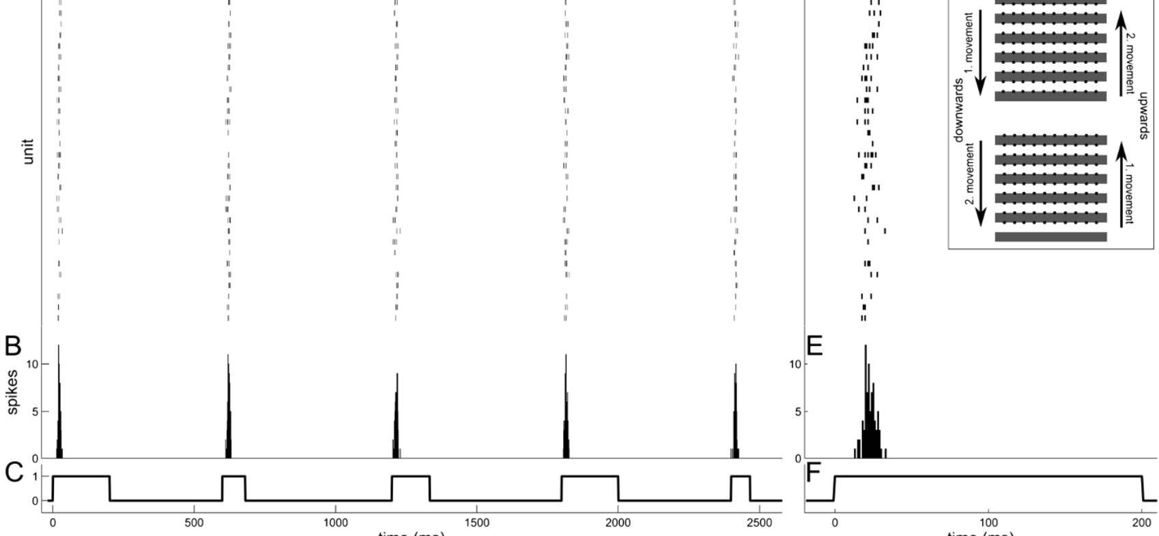
Isolated retinal recordings test rapid motion information
Kretschmer and colleagues placed isolated archerfish retinas on a multielectrode array and projected alternating black and white bars. The grating remained present while movement began at randomly selected velocities, separating motion onset from the sudden appearance of a new object.
The 400-µm bars moved upward or downward, stopping when their contrast edges reached the next electrode row. Recorded ganglion cells produced sharply timed responses after movement onset. The protocol also varied movement history so direction reversal did not occur in every step.
This preparation tests information available at retinal output before central processing. Expressing velocities as those of an object about 30 cm from the eye relates the electrode responses to the speeds of real moving targets.
Kretschmer et al. (2012), Fig. 1(A–G). Recorded retinal ganglion-cell responses and grating stimulus.
Temple et al. (2010), Fig. 3. Ganglion-cell topography aligned with the preferred shooting axis.
Kretschmer et al. (2012)
22
Notes:
• Kretschmer and colleagues placed isolated archerfish retinas on a multielectrode array and projected alternating black and white bars. The grating remained present while movement began at randomly selected velocities, separating motion onset from the sudden appearance of a new object.
– A multielectrode array records extracellular spikes from several retinal output cells simultaneously. It samples activity without recording the whole animal’s aiming movement.
• The 400-µm bars moved upward or downward, stopping when their contrast edges reached the next electrode row. Recorded ganglion cells produced sharply timed responses after movement onset. The protocol also varied movement history so direction reversal did not occur in every step.
• This preparation tests information available at retinal output before central processing. Expressing velocities as those of an object about 30 cm from the eye relates the electrode responses to the speeds of real moving targets.
References:
Kretschmer V, Kretschmer F, Ahlers MT, Ammermüller J (2012). High speed coding for velocity by archerfish retinal ganglion cells. BMC Neuroscience 13: 69. https://doi.org/10.1186/1471-2202-13-69
Temple S, Hart NS, Marshall NJ, Collin SP (2010). A spitting image: specializations in archerfish eyes for vision at the interface between air and water. Proceedings of the Royal Society B: Biological Sciences 277: 2607-2615. https://doi.org/10.1098/rspb.2010.0345
Figure: Kretschmer et al. (2012), Fig. 1(A–G). Recorded retinal ganglion-cell responses and grating stimulus.
Figure source: https://doi.org/10.1186/1471-2202-13-69
Figure: Temple et al. (2010), Fig. 3. Ganglion-cell topography aligned with the preferred shooting axis.
Figure source: https://doi.org/10.1098/rspb.2010.0345

Slide 31
A multielectrode array records many retinal neurons
A multielectrode array is a grid of recording electrodes on which an isolated tissue is placed, so that the spikes of many neurons are recorded at the same time. Retinal ganglion cells are the output neurons of the retina, and their spikes carry visual information to the brain.
Kretschmer and colleagues placed isolated archerfish retinas on the array and projected alternating black and white bars. The grating stayed present while movement began at randomly selected velocities, and the 400-µm bars moved upward or downward.
Recorded ganglion cells produced sharply timed responses after movement onset. Because the grating was already present, the responses reflect the onset of motion and not the sudden appearance of a new object.
Kretschmer et al. (2012), Fig. 1(A–G). Recorded retinal ganglion-cell responses and grating stimulus.
Temple et al. (2010), Fig. 3. Ganglion-cell topography aligned with the preferred shooting axis.
Kretschmer et al. (2012)
22a
Notes:
• The array records the retinal output directly.
• Definition.
– A multielectrode array is a grid of recording electrodes under an isolated tissue.
– It records the spikes of many neurons at the same time.
• Ganglion cells.
– They are the output neurons of the retina.
– Their spikes carry visual information toward the brain.
• Stimulus.
– Alternating black and white bars were projected onto the retina.
– The bars were 400 micrometers wide.
• Motion onset.
– The grating stayed present while movement began.
– Starting velocities were chosen at random.
• Direction.
– Bars moved upward or downward.
– Movement history varied so that direction reversal did not occur in every step.
• Response.
– Ganglion cells produced sharply timed responses after movement onset.
• Meaning.
– The responses reflect motion onset and not the sudden appearance of an object.
• Velocity scale.
– Velocities are expressed as those of an external object about 30 cm from the eye.
– They are not speeds across the retinal surface.
• Randomization.
– Starting velocities were chosen at random, so the responses cannot be explained by a fixed order of stimuli.
References:
Kretschmer V, Kretschmer F, Ahlers MT, Ammermüller J (2012). High speed coding for velocity by archerfish retinal ganglion cells. BMC Neuroscience 13: 69. https://doi.org/10.1186/1471-2202-13-69

Slide 32
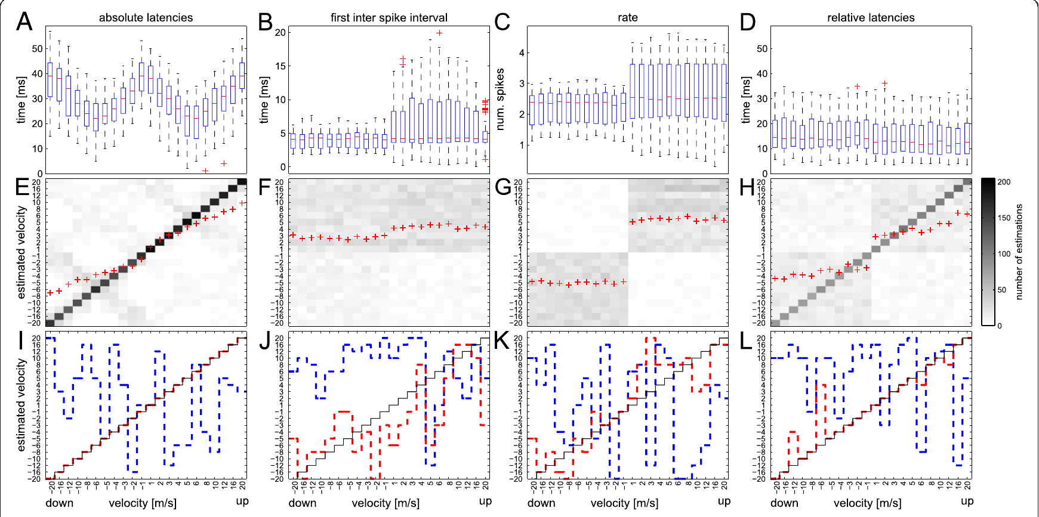
First-spike timing carries information about velocity
A first-spike latency is the interval from a reference event to the first action potential in a response. Kretschmer and colleagues compared ganglion-cell latencies across the moving-grating velocities. The shortest median absolute latencies were about 22 ms at stimulus speeds around 5–6 m/s.
Latencies increased at both lower and higher velocities. Different individual cells supplied distinct tuning profiles, allowing the population pattern to distinguish velocity better than a single median value could. A published decoder reconstructed the presented velocities most successfully from absolute first-spike latencies.
Absolute latency requires knowledge of stimulus onset, which the experimenter possesses but the brain must infer from its own signals. A decoder that reconstructs velocity from absolute latencies indicates that the timing of spikes across the population carries velocity information within tens of milliseconds of movement onset.
Kretschmer et al. (2012), Fig. 2(A–L). First-spike latency varies with stimulus velocity.
Temple et al. (2010), Fig. 3. Ganglion-cell topography aligned with the preferred shooting axis.
Kretschmer et al. (2012)
23
Notes:
• A first-spike latency is the interval from a reference event to the first action potential in a response. Kretschmer and colleagues compared ganglion-cell latencies across the moving-grating velocities. The shortest median absolute latencies were about 22 ms at stimulus speeds around 5–6 m/s.
– An action potential is a brief electrical spike used for neuronal signaling. The earliest available spike can transmit information before a long counting window is complete.
• Latencies increased at both lower and higher velocities. Different individual cells supplied distinct tuning profiles, allowing the population pattern to distinguish velocity better than a single median value could. A published decoder reconstructed the presented velocities most successfully from absolute first-spike latencies.
• Absolute latency requires knowledge of stimulus onset, which the experimenter possesses but the brain must infer from its own signals. A decoder that reconstructs velocity from absolute latencies indicates that the timing of spikes across the population carries velocity information within tens of milliseconds of movement onset.
References:
Kretschmer V, Kretschmer F, Ahlers MT, Ammermüller J (2012). High speed coding for velocity by archerfish retinal ganglion cells. BMC Neuroscience 13: 69. https://doi.org/10.1186/1471-2202-13-69
Temple S, Hart NS, Marshall NJ, Collin SP (2010). A spitting image: specializations in archerfish eyes for vision at the interface between air and water. Proceedings of the Royal Society B: Biological Sciences 277: 2607-2615. https://doi.org/10.1098/rspb.2010.0345
Figure: Kretschmer et al. (2012), Fig. 2(A–L). First-spike latency varies with stimulus velocity.
Figure source: https://doi.org/10.1186/1471-2202-13-69
Figure: Temple et al. (2010), Fig. 3. Ganglion-cell topography aligned with the preferred shooting axis.
Figure source: https://doi.org/10.1098/rspb.2010.0345

Slide 33
Relative timing outperforms the tested rate code
Kretschmer and colleagues compared absolute latency with first interspike interval, spike rate over 100 ms, and latency relative to population response onset. An interspike interval is the elapsed time between consecutive action potentials; a firing rate counts spikes per unit time.
The first interval and the tested rate measure reconstructed velocity poorly. Relative first-spike latency performed better, even though its median remained near 10 ms across velocities, because the patterns across different cells retained velocity information. Relative timing supplied an internal reference rather than the experimenter’s stimulus clock.
The comparison supports population timing as a plausible fast signal. A spike count over 100 ms is slow relative to a predictive response, whereas relative first-spike latency stays near 10 ms across velocities.
Kretschmer et al. (2012), Fig. 2(A–L). Published decoding based on latency, interval, rate and relative latency.
Temple et al. (2010), Fig. 3. Ganglion-cell topography aligned with the preferred shooting axis.
Kretschmer et al. (2012)
24
Notes:
• Kretschmer and colleagues compared absolute latency with first interspike interval, spike rate over 100 ms, and latency relative to population response onset. An interspike interval is the elapsed time between consecutive action potentials; a firing rate counts spikes per unit time.
– The four decoding panels are the authors’ original analysis. Relative latencies reference the onset of the recorded population response, not the animal’s motor response.
• The first interval and the tested rate measure reconstructed velocity poorly. Relative first-spike latency performed better, even though its median remained near 10 ms across velocities, because the patterns across different cells retained velocity information. Relative timing supplied an internal reference rather than the experimenter’s stimulus clock.
• The comparison supports population timing as a plausible fast signal. A spike count over 100 ms is slow relative to a predictive response, whereas relative first-spike latency stays near 10 ms across velocities.
References:
Kretschmer V, Kretschmer F, Ahlers MT, Ammermüller J (2012). High speed coding for velocity by archerfish retinal ganglion cells. BMC Neuroscience 13: 69. https://doi.org/10.1186/1471-2202-13-69
Temple S, Hart NS, Marshall NJ, Collin SP (2010). A spitting image: specializations in archerfish eyes for vision at the interface between air and water. Proceedings of the Royal Society B: Biological Sciences 277: 2607-2615. https://doi.org/10.1098/rspb.2010.0345
Figure: Kretschmer et al. (2012), Fig. 2(A–L). Published decoding based on latency, interval, rate and relative latency.
Figure source: https://doi.org/10.1186/1471-2202-13-69
Figure: Temple et al. (2010), Fig. 3. Ganglion-cell topography aligned with the preferred shooting axis.
Figure source: https://doi.org/10.1098/rspb.2010.0345

Slide 34
Relative latency uses an internal timing reference
Relative latency is the time of a cell's first spike measured from the onset of the population response and not from the stimulus clock. Absolute latency, by contrast, is measured from the moment the experimenter presents the stimulus. Both are first-spike measures, and they differ only in their reference.
Kretschmer and colleagues compared absolute latency with first interspike interval, spike rate over 100 ms, and latency relative to population response onset. The first interval and the tested rate measure reconstructed velocity poorly.
Relative first-spike latency performed better, although its median stayed near 10 ms across velocities, because the pattern across cells kept the velocity information. It uses an internal reference and does not need the experimenter's stimulus clock.
Kretschmer et al. (2012), Fig. 2(A–L). Published decoding based on latency, interval, rate and relative latency.
Temple et al. (2010), Fig. 3. Ganglion-cell topography aligned with the preferred shooting axis.
Kretschmer et al. (2012)
24a
Notes:
• Relative timing solves the problem of an unknown stimulus onset.
• Absolute latency.
– It is measured from the moment the stimulus is presented.
– The experimenter knows this moment, but the brain has to infer it.
• Relative latency.
– It is measured from the onset of the population response.
– The reference comes from the cells themselves.
• Comparison.
– Kretschmer and colleagues also tested the first interspike interval.
– They tested a spike rate over 100 ms as well.
• Rate measures.
– The first interval and the tested rate reconstructed velocity poorly.
• Result.
– Relative first-spike latency performed better.
– Its median stayed near 10 ms across velocities.
• Why it works.
– The pattern across different cells kept the velocity information.
– Single medians did not carry it.
• Timescale.
– A 100 ms spike count is slow compared with a predictive response.
• Population view.
– Each cell supplies a different tuning profile.
– The pattern of relative timing across cells carries the velocity.
• Reference.
– The population response onset serves as an internal clock that the retina itself provides.
– Absolute latency needs the stimulus clock of the experimenter.
References:
Kretschmer V, Kretschmer F, Ahlers MT, Ammermüller J (2012). High speed coding for velocity by archerfish retinal ganglion cells. BMC Neuroscience 13: 69. https://doi.org/10.1186/1471-2202-13-69

Slide 35
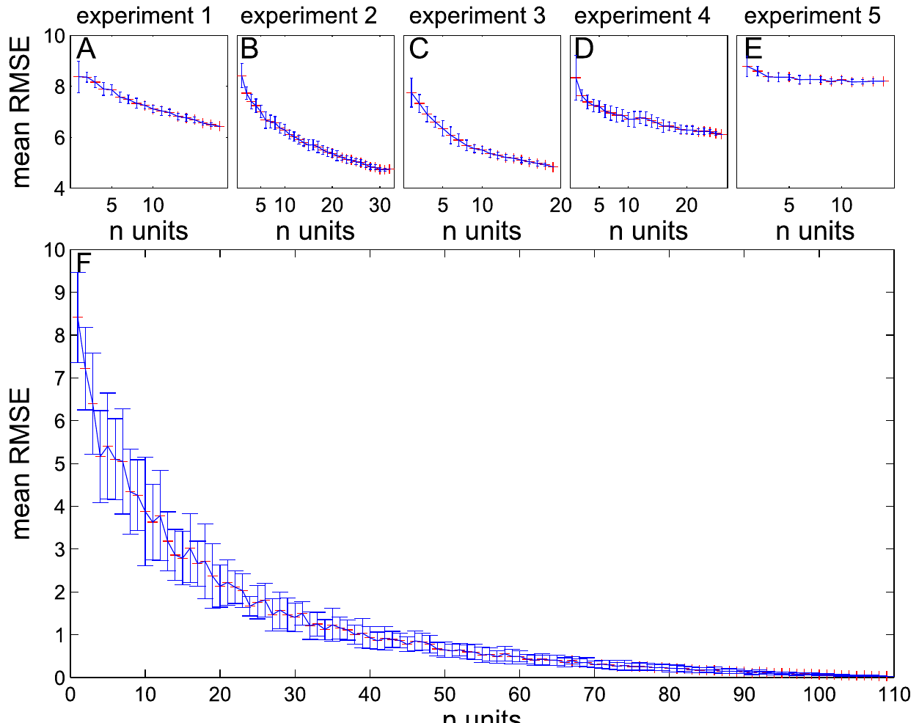
Combining ganglion cells improves velocity estimates
Kretschmer and colleagues repeatedly decoded velocity while increasing the number of recorded ganglion cells included. Published reconstruction errors fell as the population grew, but the gain was steepest for the first few cells and became smaller with additional cells.
Individual experiments differed in accuracy because response timing and tuning quality differed among their sampled cells. Even the most precisely timed unit did not reproduce the information present in a useful combination of units. Population coding therefore depends on which signals are included, not simply on an abstract cell count.
This analysis supports distributed retinal information and a limited benefit from progressively larger samples. Combining cells improves the estimate because their timing patterns carry complementary information about velocity.
Kretschmer et al. (2012), Fig. 7(A–B). Decoding error as more ganglion cells are added.
Temple et al. (2010), Fig. 3. Ganglion-cell topography aligned with the preferred shooting axis.
Kretschmer et al. (2012)
25
Notes:
• Kretschmer and colleagues repeatedly decoded velocity while increasing the number of recorded ganglion cells included. Published reconstruction errors fell as the population grew, but the gain was steepest for the first few cells and became smaller with additional cells.
– The error curves are published analyses of recorded spikes. Their flattening describes diminishing informational returns under this decoder, not an anatomical proof of redundant connections.
• Individual experiments differed in accuracy because response timing and tuning quality differed among their sampled cells. Even the most precisely timed unit did not reproduce the information present in a useful combination of units. Population coding therefore depends on which signals are included, not simply on an abstract cell count.
• This analysis supports distributed retinal information and a limited benefit from progressively larger samples. Combining cells improves the estimate because their timing patterns carry complementary information about velocity.
References:
Kretschmer V, Kretschmer F, Ahlers MT, Ammermüller J (2012). High speed coding for velocity by archerfish retinal ganglion cells. BMC Neuroscience 13: 69. https://doi.org/10.1186/1471-2202-13-69
Temple S, Hart NS, Marshall NJ, Collin SP (2010). A spitting image: specializations in archerfish eyes for vision at the interface between air and water. Proceedings of the Royal Society B: Biological Sciences 277: 2607-2615. https://doi.org/10.1098/rspb.2010.0345
Figure: Kretschmer et al. (2012), Fig. 7(A–B). Decoding error as more ganglion cells are added.
Figure source: https://doi.org/10.1186/1471-2202-13-69
Figure: Temple et al. (2010), Fig. 3. Ganglion-cell topography aligned with the preferred shooting axis.
Figure source: https://doi.org/10.1098/rspb.2010.0345

Slide 36
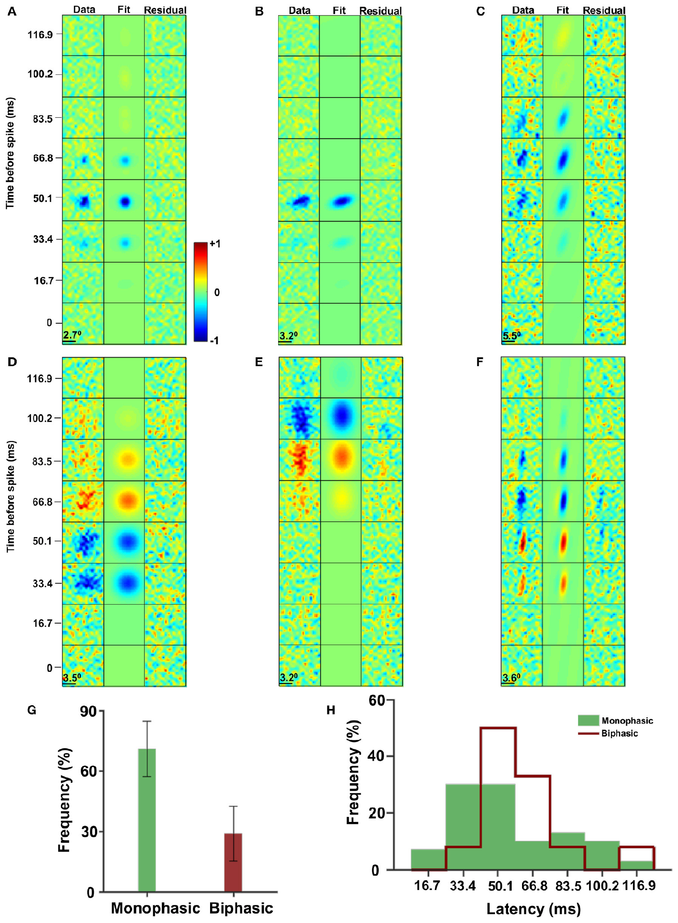
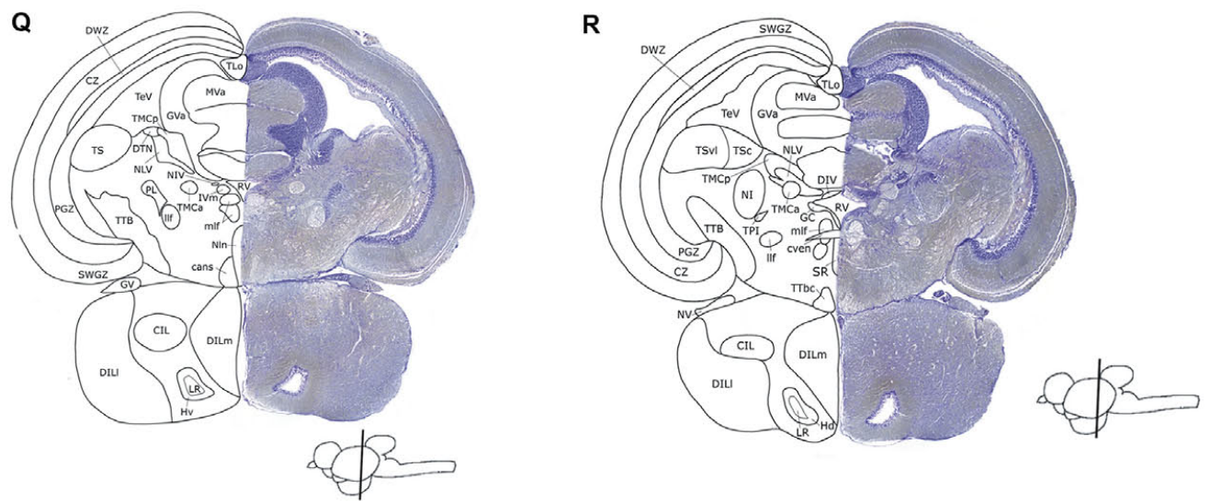
Tectal neurons integrate spatial and temporal contrast
The optic tectum is a midbrain structure receiving visual input and participating in sensorimotor processing. Reichenthal and colleagues recorded extracellular activity in archerfish while presenting random checkerboards. A spike-triggered average described the stimulus patterns preceding each neuron’s spikes.
Receptive fields ranged from nearly circular to elongated. About 68% of the sampled cells had a monophasic temporal profile, whereas the remaining group had two phases with opposite contrast signs. Mean estimated response latencies were 54.5 ms and 60 ms for these groups.
These measurements distinguish spatial sampling from the temporal contrast sequence associated with firing. A receptive field is the stimulus region and pattern that changes a neuron’s activity. Each tectal neuron is thus described by where in space and when in time a stimulus changes its firing.
Reichenthal et al. (2018), Fig. 2(A–H). Spatial and temporal receptive fields of tectal neurons.
Karoubi et al. (2016), Fig. 3(Q–R). Published Nissl-stained sections and labeled brain structures.
Reichenthal et al. (2018)
26
Notes:
• The optic tectum is a midbrain structure receiving visual input and participating in sensorimotor processing. Reichenthal and colleagues recorded extracellular activity in archerfish while presenting random checkerboards. A spike-triggered average described the stimulus patterns preceding each neuron’s spikes.
– A spike-triggered average is the average stimulus history before spikes, compared with the overall stimulus ensemble. Its positive and negative lobes describe contrast preference.
• Receptive fields ranged from nearly circular to elongated. About 68% of the sampled cells had a monophasic temporal profile, whereas the remaining group had two phases with opposite contrast signs. Mean estimated response latencies were 54.5 ms and 60 ms for these groups.
• These measurements distinguish spatial sampling from the temporal contrast sequence associated with firing. A receptive field is the stimulus region and pattern that changes a neuron’s activity. Each tectal neuron is thus described by where in space and when in time a stimulus changes its firing.
References:
Reichenthal A, Ben-Tov M, Segev R (2018). Coding Schemes in the Archerfish Optic Tectum. Frontiers in Neural Circuits 12: 18. https://doi.org/10.3389/fncir.2018.00018
Karoubi N, Segev R, Wullimann MF (2016). The Brain of the Archerfish Toxotes chatareus: A Nissl-Based Neuroanatomical Atlas and Catecholaminergic/Cholinergic Systems. Frontiers in Neuroanatomy 10: 106. https://doi.org/10.3389/fnana.2016.00106
Figure: Reichenthal et al. (2018), Fig. 2(A–H). Spatial and temporal receptive fields of tectal neurons.
Figure source: https://doi.org/10.3389/fncir.2018.00018
Figure: Karoubi et al. (2016), Fig. 3(Q–R). Published Nissl-stained sections and labeled brain structures.
Figure source: https://doi.org/10.3389/fnana.2016.00106

Slide 37
A spike-triggered average describes preferred stimuli
A spike-triggered average is the mean of the stimulus patterns that preceded each spike of a neuron. It describes which stimulus features, in space and time, tend to make the neuron fire.
Reichenthal and colleagues recorded extracellular activity in the optic tectum of archerfish while presenting random checkerboards. About 68% of the sampled cells had a monophasic temporal profile, whereas the remaining group had two phases with opposite contrast signs. Mean estimated response latencies were 54.5 ms and 60 ms for these groups.
Receptive fields ranged from nearly circular to elongated. The average therefore gives a spatial pattern and a temporal profile for each cell, which is the information used to compare tectal neurons.
Reichenthal et al. (2018), Fig. 2(A–H). Spatial and temporal receptive fields of tectal neurons.
Karoubi et al. (2016), Fig. 3(Q–R). Published Nissl-stained sections and labeled brain structures.
Reichenthal et al. (2018)
26a
Notes:
• The spike-triggered average turns a spike record into a description of the preferred stimulus.
• Definition.
– It is the mean of the stimulus patterns that preceded each spike.
– It reveals which features make a neuron fire.
• Stimulus.
– Random checkerboards were presented to the archerfish.
– Extracellular activity was recorded in the optic tectum.
• Receptive fields.
– A receptive field is the stimulus region and pattern that changes a neuron's activity.
– Fields ranged from nearly circular to elongated.
• Temporal profiles.
– About 68% of sampled cells had a monophasic profile.
– The remaining cells had two phases with opposite contrast signs.
• Latencies.
– Mean estimated latencies were 54.5 ms and 60 ms for the two groups.
• Structure.
– The tectum is a midbrain structure that receives visual input.
– It takes part in sensorimotor processing.
• Consequence.
– Each cell is described by where and when a stimulus changes its firing.
• Nonlinear step.
– An average alone can miss part of the response structure of a cell.
– Additional analyses use several temporal filters per cell.
References:
Reichenthal A, Ben-Tov M, Segev R (2018). Coding Schemes in the Archerfish Optic Tectum. Frontiers in Neural Circuits 12: 18. https://doi.org/10.3389/fncir.2018.00018

Slide 38
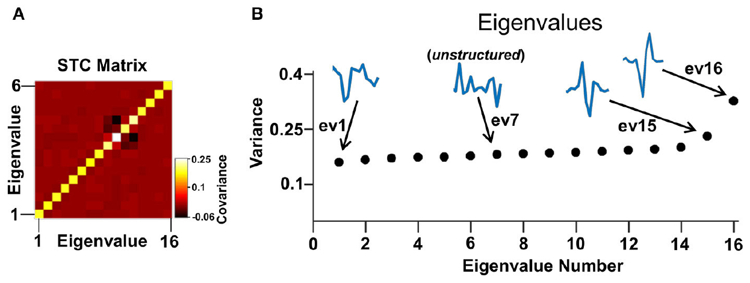
Additional temporal filters capture tectal selectivity
Reichenthal and colleagues also presented full-field flashes with varying intensity to reduce the visual stimulus to a time series. They used spike-triggered covariance, which compares variation in the stimulus histories preceding spikes with variation in the full stimulus set.
Structured temporal filters identified combinations of earlier light levels associated with the response. Cells could be described by one to three relevant filters, with two most common. Some filters were termed excitatory or inhibitory according to their statistical relation to the stimulus ensemble.
Excitatory and inhibitory filters describe how earlier light levels increase or decrease the response of a cell. The analysis adds information missed by an average alone, because it captures several filters per cell.
Reichenthal et al. (2018), Fig. 4(A–B). Published covariance analysis and significant stimulus filters.
Karoubi et al. (2016), Fig. 3(Q–R). Published Nissl-stained sections and labeled brain structures.
Reichenthal et al. (2018)
27
Notes:
• Reichenthal and colleagues also presented full-field flashes with varying intensity to reduce the visual stimulus to a time series. They used spike-triggered covariance, which compares variation in the stimulus histories preceding spikes with variation in the full stimulus set.
– A temporal filter weights portions of the preceding light history. The published eigenvectors belong to an analytical response model, not a reconstructed anatomical circuit.
• Structured temporal filters identified combinations of earlier light levels associated with the response. Cells could be described by one to three relevant filters, with two most common. Some filters were termed excitatory or inhibitory according to their statistical relation to the stimulus ensemble.
• Excitatory and inhibitory filters describe how earlier light levels increase or decrease the response of a cell. The analysis adds information missed by an average alone, because it captures several filters per cell.
References:
Reichenthal A, Ben-Tov M, Segev R (2018). Coding Schemes in the Archerfish Optic Tectum. Frontiers in Neural Circuits 12: 18. https://doi.org/10.3389/fncir.2018.00018
Karoubi N, Segev R, Wullimann MF (2016). The Brain of the Archerfish Toxotes chatareus: A Nissl-Based Neuroanatomical Atlas and Catecholaminergic/Cholinergic Systems. Frontiers in Neuroanatomy 10: 106. https://doi.org/10.3389/fnana.2016.00106
Figure: Reichenthal et al. (2018), Fig. 4(A–B). Published covariance analysis and significant stimulus filters.
Figure source: https://doi.org/10.3389/fncir.2018.00018
Figure: Karoubi et al. (2016), Fig. 3(Q–R). Published Nissl-stained sections and labeled brain structures.
Figure source: https://doi.org/10.3389/fnana.2016.00106

Slide 39
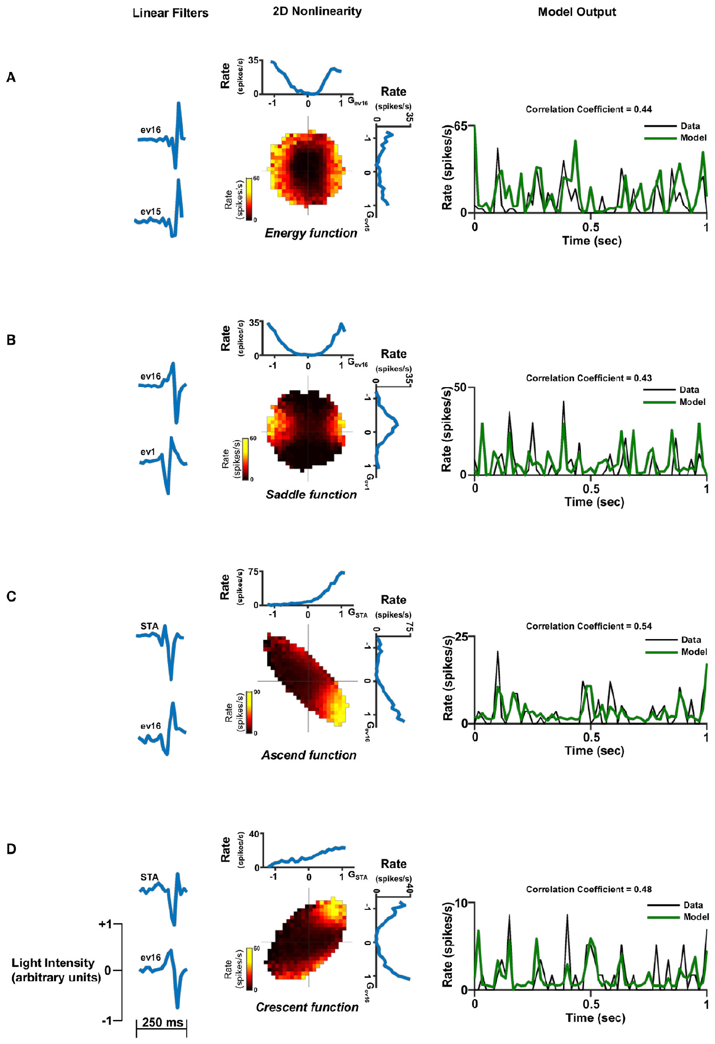
Nonlinear combinations predict different tectal responses
Reichenthal and colleagues fitted models that combined the recovered temporal filters through nonlinear response functions. A nonlinearity means that the response combines the filter outputs non-additively, so the joint values of the filters can change how strongly the neuron fires. The nonlinear combination is the step that distinguishes these models from linear descriptions of the same filters.
The original examples included one-, two- and three-filter descriptions with different response surfaces. Two-filter models reproduced response structure that an average-based single filter missed. The authors compared model output with recorded firing rates, so each model is tested against the measured responses. Each model thus carries a specific prediction for the neuron's firing across combinations of inputs.
These are phenomenological models, compact descriptions of measured input–output relationships. The diverse combinations provide candidate transformations of visual timing before a motor decision, and each combination specifies a distinct response surface. These models therefore describe how the visual timing signal is transformed before the response. Each description is a candidate for how the timing signal is transformed, and the measured firing rates decide among them.
Reichenthal et al. (2018), Fig. 7(A–D). Original two-filter nonlinear response models and neural recordings.
Karoubi et al. (2016), Fig. 3(Q–R). Published Nissl-stained sections and labeled brain structures.
Reichenthal et al. (2018)
28
Notes:
• Reichenthal and colleagues fitted models that combined the recovered temporal filters through nonlinear response functions. A nonlinearity means the response cannot be described simply by proportional addition of all filter outputs; the joint values can change how strongly the neuron fires.
– The displayed response surfaces and traces are the original published models and recordings. No surface, trace or model curve has been recreated.
• Original examples included one-, two- and three-filter descriptions with different response surfaces. Two-filter models could reproduce response structure that an average-based single filter missed. The authors compared model output with recorded firing rather than judging the inferred filters solely by their appearance.
• These are phenomenological models: compact descriptions of measured input–output relationships. The diverse combinations provide candidate transformations of visual timing before a motor decision.
References:
Reichenthal A, Ben-Tov M, Segev R (2018). Coding Schemes in the Archerfish Optic Tectum. Frontiers in Neural Circuits 12: 18. https://doi.org/10.3389/fncir.2018.00018
Karoubi N, Segev R, Wullimann MF (2016). The Brain of the Archerfish Toxotes chatareus: A Nissl-Based Neuroanatomical Atlas and Catecholaminergic/Cholinergic Systems. Frontiers in Neuroanatomy 10: 106. https://doi.org/10.3389/fnana.2016.00106
Figure: Reichenthal et al. (2018), Fig. 7(A–D). Original two-filter nonlinear response models and neural recordings.
Figure source: https://doi.org/10.3389/fncir.2018.00018
Figure: Karoubi et al. (2016), Fig. 3(Q–R). Published Nissl-stained sections and labeled brain structures.
Figure source: https://doi.org/10.3389/fnana.2016.00106

Slide 40
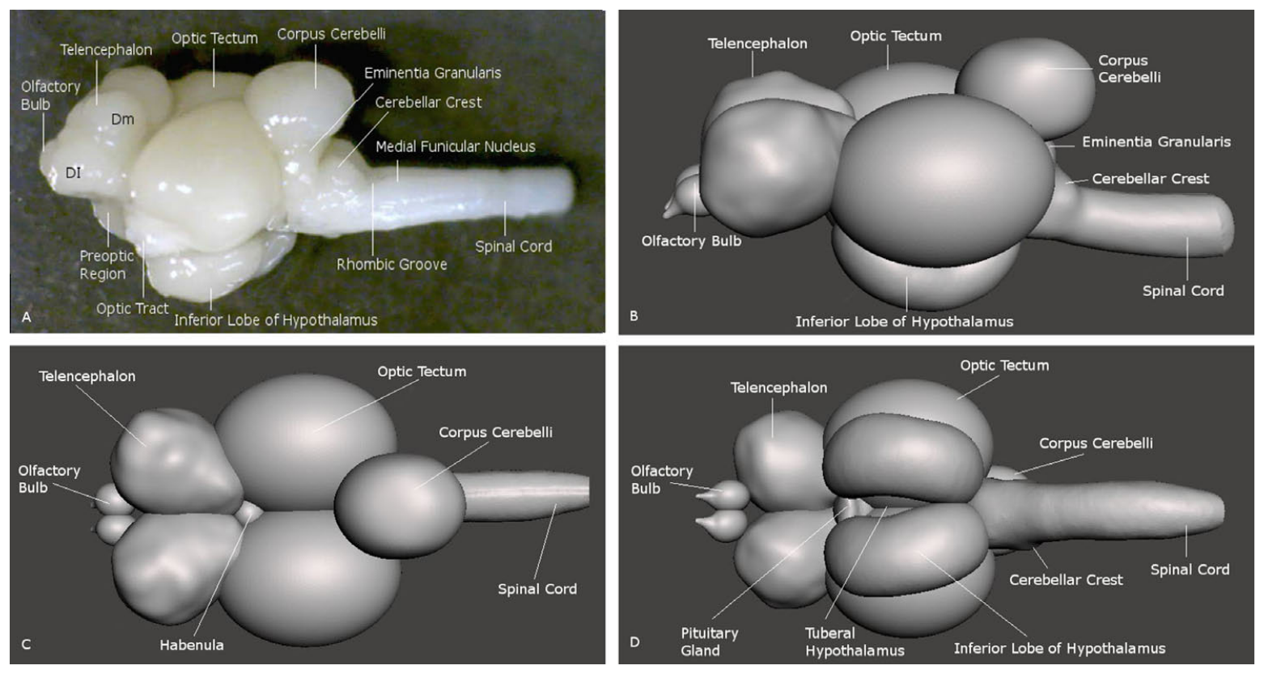
A brain atlas separates visual and descending structures
Karoubi and colleagues examined Toxotes chatareus brains with Nissl staining and immunohistochemistry. Nissl staining labels cell-rich tissue and helps distinguish nuclei and layers; immunohistochemistry uses antibodies to locate selected molecular markers within the tissue.
The atlas documents the telencephalon, diencephalon, optic tectum, cerebellum and hindbrain in serial sections and whole-brain views. Its labeled sections supply anatomical landmarks for interpreting visual recordings and the location of descending neurons, rather than assuming that all activity comes from a single undifferentiated brain region.
The atlas also maps catecholaminergic and cholinergic markers, which identify cell groups by the transmitter they use. A cholinergic neuron uses acetylcholine.
Karoubi et al. (2016), Fig. 2(A–D). Lateral view and reconstruction of the archerfish brain.
Karoubi et al. (2016)
29
Notes:
• Karoubi and colleagues examined Toxotes chatareus brains with Nissl staining and immunohistochemistry. Nissl staining labels cell-rich tissue and helps distinguish nuclei and layers; immunohistochemistry uses antibodies to locate selected molecular markers within the tissue.
– Serial anatomy supplies a coordinate framework for physiological studies. The atlas does not trace a complete retinal-to-Mauthner interception pathway.
• The atlas documents the telencephalon, diencephalon, optic tectum, cerebellum and hindbrain in serial sections and whole-brain views. Its labeled sections supply anatomical landmarks for interpreting visual recordings and the location of descending neurons, rather than assuming that all activity comes from a single undifferentiated brain region.
• The atlas also maps catecholaminergic and cholinergic markers, which identify cell groups by the transmitter they use. A cholinergic neuron uses acetylcholine.
References:
Karoubi N, Segev R, Wullimann MF (2016). The Brain of the Archerfish Toxotes chatareus: A Nissl-Based Neuroanatomical Atlas and Catecholaminergic/Cholinergic Systems. Frontiers in Neuroanatomy 10: 106. https://doi.org/10.3389/fnana.2016.00106
Figure: Karoubi et al. (2016), Fig. 2(A–D). Lateral view and reconstruction of the archerfish brain.
Figure source: https://doi.org/10.3389/fnana.2016.00106

Slide 41
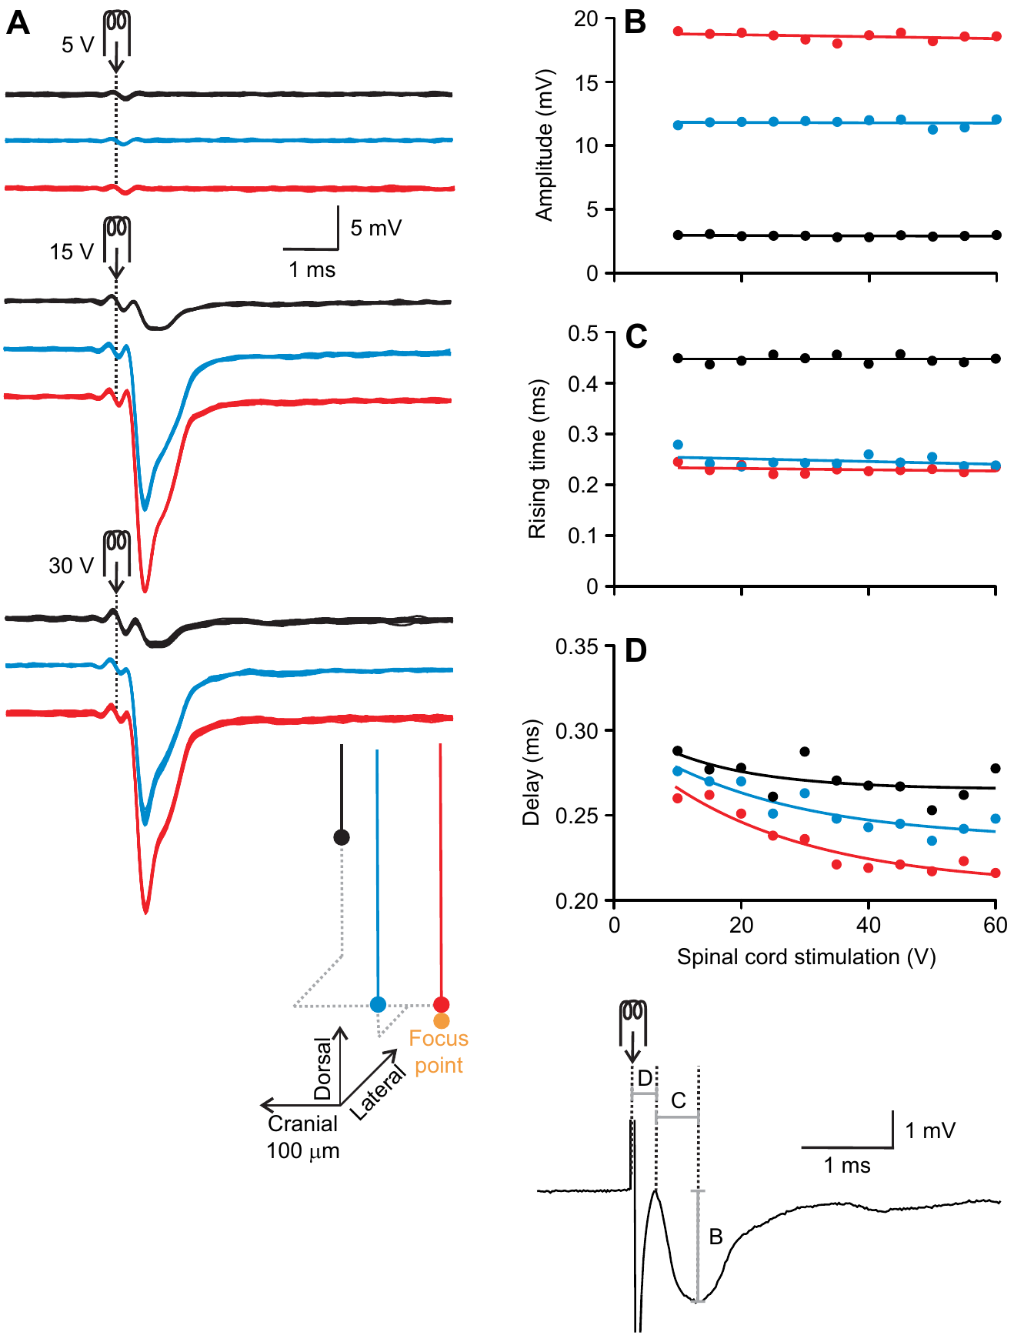
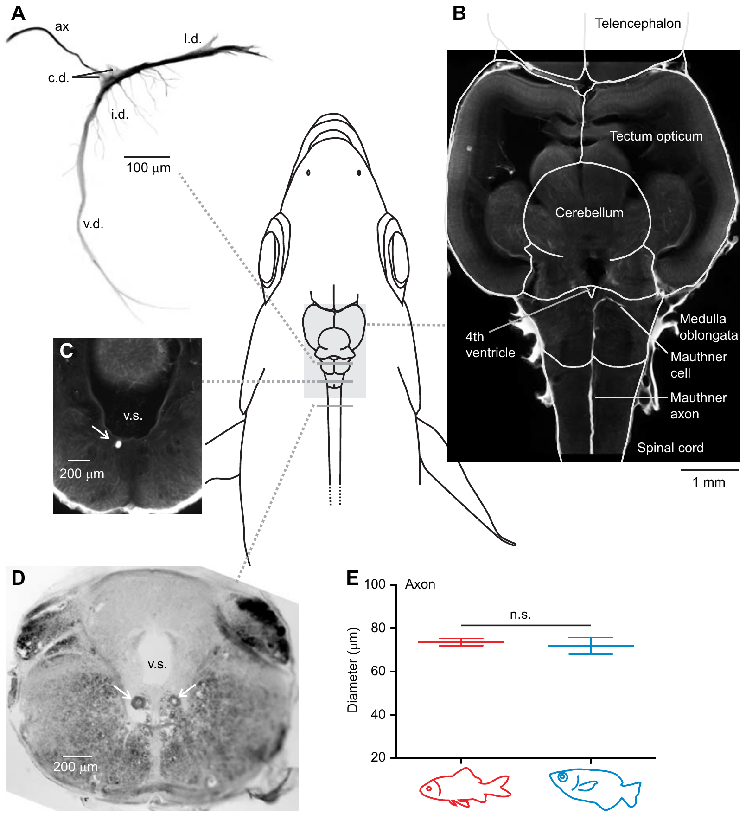
An electrical field signature locates the Mauthner cell
The Mauthner cell is a large hindbrain neuron with a descending axon associated with fast-start behavior in fishes. Machnik and colleagues stimulated the spinal cord and searched the archerfish hindbrain for a characteristic short-latency, all-or-none extracellular field potential.
Increasing a stimulus above threshold changed whether the signal occurred but did not progressively scale its amplitude. Each side of the hindbrain contained a distinct focus, consistent with a paired neuronal source. Intracellular penetration and subsequent staining then linked that source to a cell with Mauthner-like morphology.
This approach connects an electrical signature to anatomy instead of relying only on cell size. It establishes an experimentally accessible Mauthner neuron in archerfish. Antidromic stimulation travels backward from axon toward cell body, so the recorded all-or-none signal reports the spike of the cell itself.
Machnik et al. (2018a), Fig. 2(A–D). All-or-none field potential used to locate the Mauthner cell.
Machnik et al. (2018a), Fig. 6(A–E). Hindbrain Mauthner cell and giant crossed spinal axons.
Machnik et al. (2018a)
30
Notes:
• The Mauthner cell is a large hindbrain neuron with a descending axon associated with fast-start behavior in fishes. Machnik and colleagues stimulated the spinal cord and searched the archerfish hindbrain for a characteristic short-latency, all-or-none extracellular field potential.
– All-or-none refers to the recruitment of a spike once threshold is reached. The focused extracellular signal also depends on the axon-cap geometry around the cell.
• Increasing a stimulus above threshold changed whether the signal occurred but did not progressively scale its amplitude. Each side of the hindbrain contained a distinct focus, consistent with a paired neuronal source. Intracellular penetration and subsequent staining then linked that source to a cell with Mauthner-like morphology.
• This approach connects an electrical signature to anatomy instead of relying only on cell size. It establishes an experimentally accessible Mauthner neuron in archerfish. Antidromic stimulation travels backward from axon toward cell body, so the recorded all-or-none signal reports the spike of the cell itself.
References:
Machnik P, Leupolz K, Feyl S, Schulze W, Schuster S (2018a). The Mauthner cell in a fish with top-performance and yet flexibly-tuned C-starts I. Identification and comparative morphology. Journal of Experimental Biology 221: jeb.182535. https://doi.org/10.1242/jeb.182535
Figure: Machnik et al. (2018a), Fig. 2(A–D). All-or-none field potential used to locate the Mauthner cell.
Figure source: https://doi.org/10.1242/jeb.182535
Figure: Machnik et al. (2018a), Fig. 6(A–E). Hindbrain Mauthner cell and giant crossed spinal axons.
Figure source: https://doi.org/10.1242/jeb.182535

Slide 42
Antidromic stimulation identifies a cell by its axon
Antidromic stimulation sends a spike backward along an axon, from the axon toward the cell body, so that the neuron fires without synaptic input. A field potential is the extracellular voltage generated by the currents of a cell or group of cells. The signal can therefore be used to locate the cell before it is filled with dye.
Machnik and colleagues stimulated the spinal cord and searched the archerfish hindbrain for a characteristic short-latency, all-or-none extracellular field potential. Increasing a stimulus above threshold changed whether the signal occurred but did not progressively scale its amplitude.
Each side of the hindbrain contained a distinct focus, consistent with a paired neuronal source. Intracellular penetration and subsequent staining then linked that source to a cell with Mauthner-like morphology.
Machnik et al. (2018a), Fig. 2(A–D). All-or-none field potential used to locate the Mauthner cell.
Machnik et al. (2018a), Fig. 6(A–E). Hindbrain Mauthner cell and giant crossed spinal axons.
Machnik et al. (2018a)
30a
Notes:
• Antidromic stimulation makes it possible to find a specific neuron without knowing its inputs.
• Definition.
– A spike is sent backward along the axon toward the cell body.
– The neuron fires without synaptic input.
• Field potential.
– It is the extracellular voltage produced by the currents of a cell or group of cells.
• Search.
– Machnik and colleagues stimulated the spinal cord.
– They searched the hindbrain for a short-latency, all-or-none potential.
• All or none.
– A stimulus above threshold changed whether the signal occurred.
– The amplitude did not scale with stimulus strength.
• Paired source.
– Each side of the hindbrain contained a distinct focus.
• Identification.
– Intracellular penetration and staining linked the source to a cell.
– The cell had Mauthner-like morphology.
• Summary.
– The electrical signature allows the cell to be found by its response and not by its size.
– Staining then confirms its shape.
• Threshold behavior.
– Raising the stimulus above threshold switched the signal on and did not make it larger.
– This all-or-none property is what a spike of a single large cell would produce.
References:
Machnik P, Leupolz K, Feyl S, Schulze W, Schuster S (2018a). The Mauthner cell in a fish with top-performance and yet flexibly-tuned C-starts I. Identification and comparative morphology. Journal of Experimental Biology 221: jeb.182535. https://doi.org/10.1242/jeb.182535

Slide 43
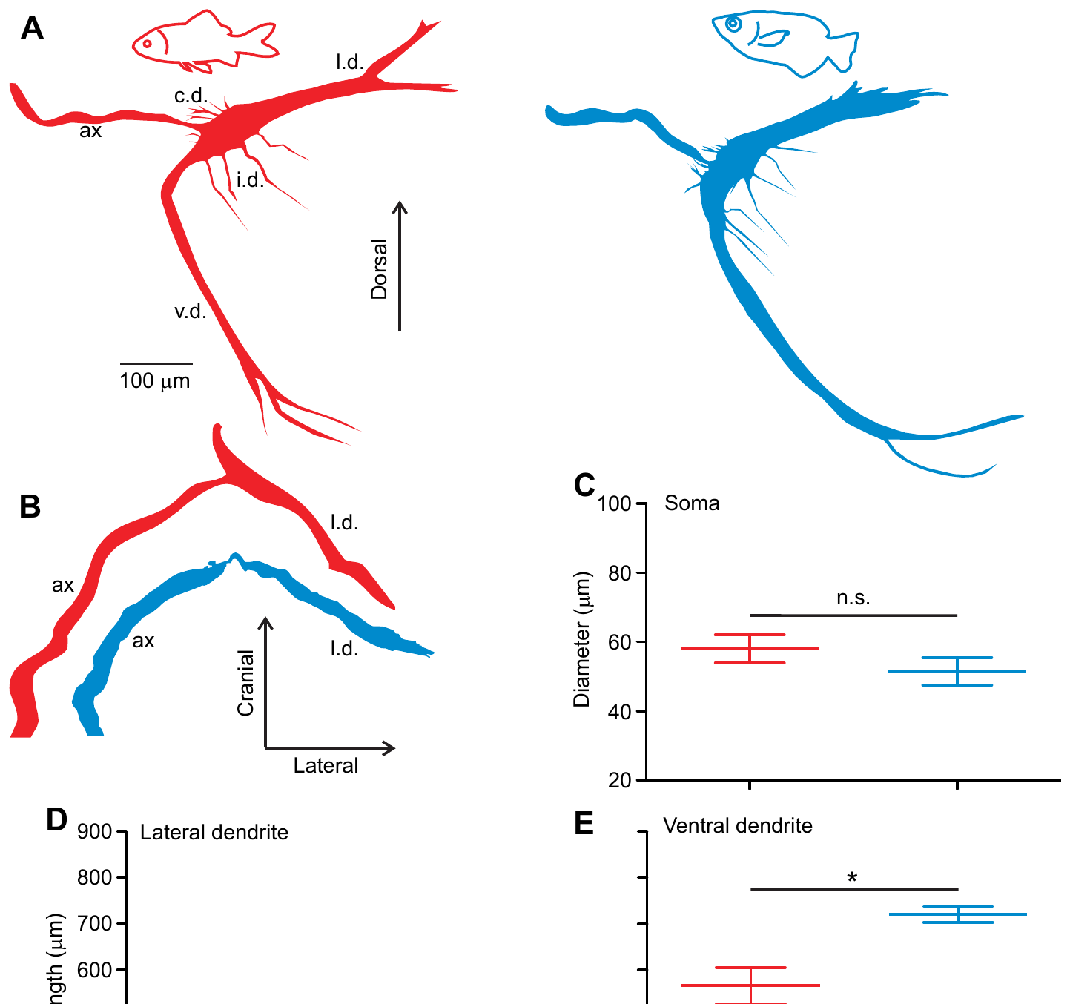
Mauthner morphology resembles that of goldfish
Machnik and colleagues filled identified Mauthner neurons and compared archerfish with similarly sized goldfish processed by the same method. The soma is the neuronal cell body; dendrites receive and integrate inputs before signals reach the spike-initiation region.
Archerfish soma diameters ranged from 45 to 63 µm, compared with 47–66 µm in goldfish. Both had prominent lateral and ventral dendrites, an axon hillock, and smaller branches. The broad similarity persisted despite the archerfish’s specialized interception demands.
The matched preparation controls for major differences caused by animal size and staining method. It argues against a dramatically enlarged or uniquely shaped Mauthner neuron as a necessary explanation of the archerfish skill. The archerfish cell therefore has the same overall plan as the goldfish cell, with dendrites receiving input and the axon hillock initiating the spike.
Machnik et al. (2018a), Fig. 5(A–E). Published cell reconstructions and soma/dendrite comparisons.
Machnik et al. (2018a)
31
Notes:
• Machnik and colleagues filled identified Mauthner neurons and compared archerfish with similarly sized goldfish processed by the same method. The soma is the neuronal cell body; dendrites receive and integrate inputs before signals reach the spike-initiation region.
– The red and blue cell reconstructions are original published anatomical reconstructions. Their colors and dimensions have not been changed.
• Archerfish soma diameters ranged from 45 to 63 µm, compared with 47–66 µm in goldfish. Both had prominent lateral and ventral dendrites, an axon hillock, and smaller branches. The broad similarity persisted despite the archerfish’s specialized interception demands.
• The matched preparation controls for major differences caused by animal size and staining method. It argues against a dramatically enlarged or uniquely shaped Mauthner neuron as a necessary explanation of the archerfish skill. The archerfish cell therefore has the same overall plan as the goldfish cell, with dendrites receiving input and the axon hillock initiating the spike.
References:
Machnik P, Leupolz K, Feyl S, Schulze W, Schuster S (2018a). The Mauthner cell in a fish with top-performance and yet flexibly-tuned C-starts I. Identification and comparative morphology. Journal of Experimental Biology 221: jeb.182535. https://doi.org/10.1242/jeb.182535
Figure: Machnik et al. (2018a), Fig. 5(A–E). Published cell reconstructions and soma/dendrite comparisons.
Figure source: https://doi.org/10.1242/jeb.182535

Slide 44
Two crossed giant axons dominate the spinal cord
After staining identified cells, Machnik and colleagues followed the Mauthner axons across the hindbrain midline and into the opposite spinal cord. Unstained cross-sections independently contained two exceptionally large axons in the corresponding positions.
The largest axons averaged 71.9 µm in diameter in the measured archerfish sections and were comparable with those of similarly sized goldfish. Finding exactly two matched giants argued against an additional, equally large descending pathway hidden elsewhere in the sampled cord.
A large axon can support rapid conduction, making this anatomy compatible with a fast motor command. Two crossed giants of about 71.9 µm in diameter mean that each Mauthner cell sends a fast signal to the opposite side of the spinal cord.
Machnik et al. (2018a), Fig. 6(A–E). Hindbrain Mauthner cell and giant crossed spinal axons.
Machnik et al. (2018a)
32
Notes:
• After staining identified cells, Machnik and colleagues followed the Mauthner axons across the hindbrain midline and into the opposite spinal cord. Unstained cross-sections independently contained two exceptionally large axons in the corresponding positions.
– The original stained and unstained sections provide complementary identification controls. Crossing means that an axon descends on the side opposite its hindbrain cell body.
• The largest axons averaged 71.9 µm in diameter in the measured archerfish sections and were comparable with those of similarly sized goldfish. Finding exactly two matched giants argued against an additional, equally large descending pathway hidden elsewhere in the sampled cord.
• A large axon can support rapid conduction, making this anatomy compatible with a fast motor command. Two crossed giants of about 71.9 µm in diameter mean that each Mauthner cell sends a fast signal to the opposite side of the spinal cord.
References:
Machnik P, Leupolz K, Feyl S, Schulze W, Schuster S (2018a). The Mauthner cell in a fish with top-performance and yet flexibly-tuned C-starts I. Identification and comparative morphology. Journal of Experimental Biology 221: jeb.182535. https://doi.org/10.1242/jeb.182535
Figure: Machnik et al. (2018a), Fig. 6(A–E). Hindbrain Mauthner cell and giant crossed spinal axons.
Figure source: https://doi.org/10.1242/jeb.182535

Slide 45
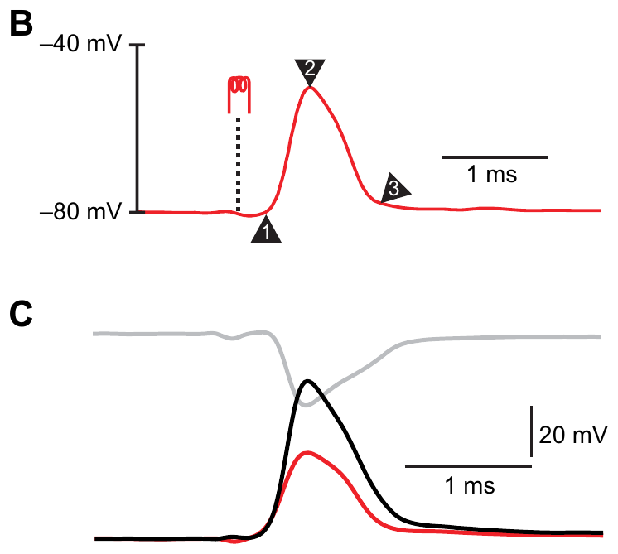
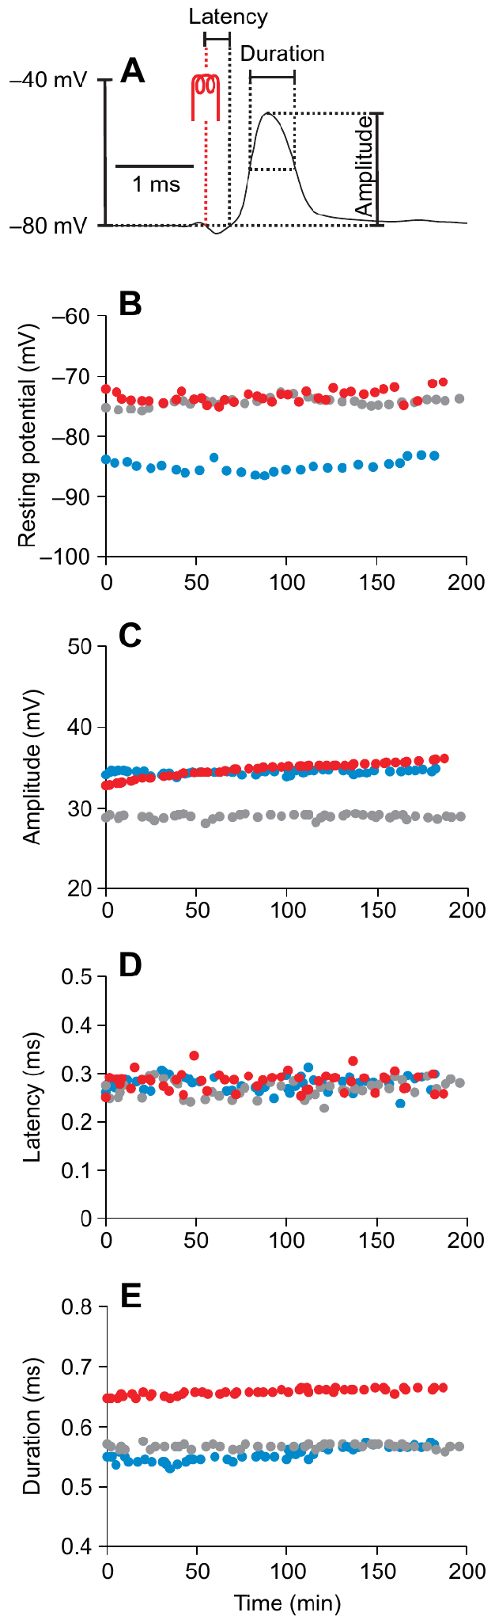
Intracellular spikes reveal a rapid excitable output neuron
Machnik and colleagues obtained intracellular recordings from identified archerfish Mauthner cells. Mean resting voltage was −79.5 mV, antidromic spike onset latency was 0.265 ms, and the somatically recorded spike had a half-maximal duration of 0.54 ms. The membrane recording gives the cell's own voltage, which is the quantity that controls its spiking.
The apparently small somatic spike, about 36.7 mV, must be read together with the extracellular field around the cell. Subtracting the nearby external potential reconstructs the actual membrane-voltage change, so the corrected signal reflects the cell's own voltage. The corrected trace is the signal used to compare the cell's response across sensory and inhibitory conditions.
These recordings remained stable for approximately 2–3 hours, permitting repeated sensory and inhibitory tests within one cell. A spike onset latency of 0.265 ms and a half-maximal duration of 0.54 ms mark a rapidly conducting output neuron that signals fast. The fast latency therefore shapes the timing of the escape response that the neuron drives.
Machnik et al. (2018b), Fig. 1(B–C). Antidromic spike and correction for the extracellular field.
Machnik et al. (2018b), Fig. 2(A–E). Intracellular recording stability and action-potential measurements.
Machnik et al. (2018b)
33
Notes:
• Machnik and colleagues obtained intracellular recordings from identified archerfish Mauthner cells. Mean resting voltage was −79.5 mV, antidromic spike onset latency was 0.265 ms, and the somatically recorded spike had a half-maximal duration of 0.54 ms.
– The transmembrane potential is the voltage inside the cell relative to the immediately adjacent extracellular space. The distant reference can include the local spike-associated field.
• The apparently small somatic spike, approximately 36.7 mV, must be interpreted with the extracellular field surrounding the cell. Subtracting the nearby external potential reconstructs the actual membrane-voltage change; a distant reference electrode alone does not directly measure that difference.
• These recordings remained stable for approximately 2–3 hours, permitting repeated sensory and inhibitory tests within one cell. An action potential is the regenerative electrical event that can propagate down the axon. A spike onset latency of 0.265 ms and a half-maximal duration of 0.54 ms mark a rapidly conducting, fast-signaling output neuron.
References:
Machnik P, Leupolz K, Feyl S, Schulze W, Schuster S (2018b). The Mauthner cell in a fish with top-performance and yet flexibly-tuned C-starts II. Physiology. Journal of Experimental Biology 221: jeb.175588. https://doi.org/10.1242/jeb.175588
Figure: Machnik et al. (2018b), Fig. 1(B–C). Antidromic spike and correction for the extracellular field.
Figure source: https://doi.org/10.1242/jeb.175588
Figure: Machnik et al. (2018b), Fig. 2(A–E). Intracellular recording stability and action-potential measurements.
Figure source: https://doi.org/10.1242/jeb.175588

Slide 46
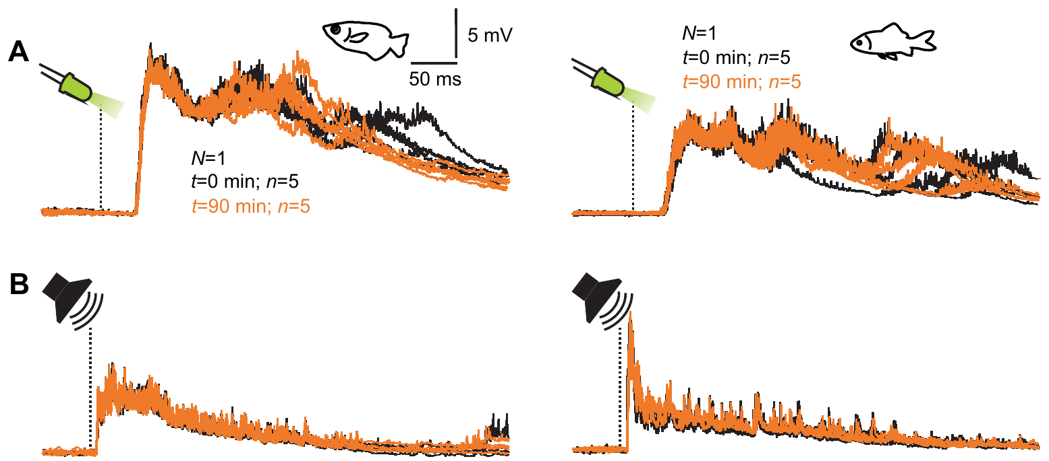
Acoustic stimuli evoke early Mauthner depolarization
Machnik and colleagues delivered brief acoustic bursts while recording the Mauthner cell. A postsynaptic potential, or PSP, is a membrane-voltage change associated with synaptic input. Under their stimulus conditions, detectable acoustic PSPs began after 7.4–15.1 ms in archerfish.
The mean acoustic PSP amplitude was 4.3 mV, and some preparations produced no detectable acoustic PSP despite strong visually evoked responses. The same standardized stimulus and recording conditions were used in the comparison with goldfish, permitting a controlled species contrast.
Latency and amplitude measure different properties of an input, so an earlier onset is separate from the size of the influence on firing. Acoustic PSPs mean that the Mauthner cell receives mechanosensory input as well as visual input.
Machnik et al. (2018b), Fig. 4(A–B). Sound- and light-evoked postsynaptic potentials in the same preparations.
Machnik et al. (2018a), Fig. 5(A–E). Published cell reconstructions and soma/dendrite comparisons.
Machnik et al. (2018b)
34
Notes:
• Machnik and colleagues delivered brief acoustic bursts while recording the Mauthner cell. A postsynaptic potential, or PSP, is a membrane-voltage change associated with synaptic input. Under their stimulus conditions, detectable acoustic PSPs began after 7.4–15.1 ms in archerfish.
– Depolarization is movement of membrane voltage toward less negative values. The original recordings compare acoustic responses in archerfish and goldfish under the same conditions.
• The mean acoustic PSP amplitude was 4.3 mV, and some preparations produced no detectable acoustic PSP despite strong visually evoked responses. The same standardized stimulus and recording conditions were used in the comparison with goldfish, permitting a controlled species contrast.
• Latency and amplitude measure different properties of an input, so an earlier onset is separate from the size of the influence on firing. Acoustic PSPs mean that the Mauthner cell receives mechanosensory input as well as visual input.
References:
Machnik P, Leupolz K, Feyl S, Schulze W, Schuster S (2018b). The Mauthner cell in a fish with top-performance and yet flexibly-tuned C-starts II. Physiology. Journal of Experimental Biology 221: jeb.175588. https://doi.org/10.1242/jeb.175588
Machnik P, Leupolz K, Feyl S, Schulze W, Schuster S (2018a). The Mauthner cell in a fish with top-performance and yet flexibly-tuned C-starts I. Identification and comparative morphology. Journal of Experimental Biology 221: jeb.182535. https://doi.org/10.1242/jeb.182535
Figure: Machnik et al. (2018b), Fig. 4(A–B). Sound- and light-evoked postsynaptic potentials in the same preparations.
Figure source: https://doi.org/10.1242/jeb.175588
Figure: Machnik et al. (2018a), Fig. 5(A–E). Published cell reconstructions and soma/dendrite comparisons.
Figure source: https://doi.org/10.1242/jeb.182535

Slide 47
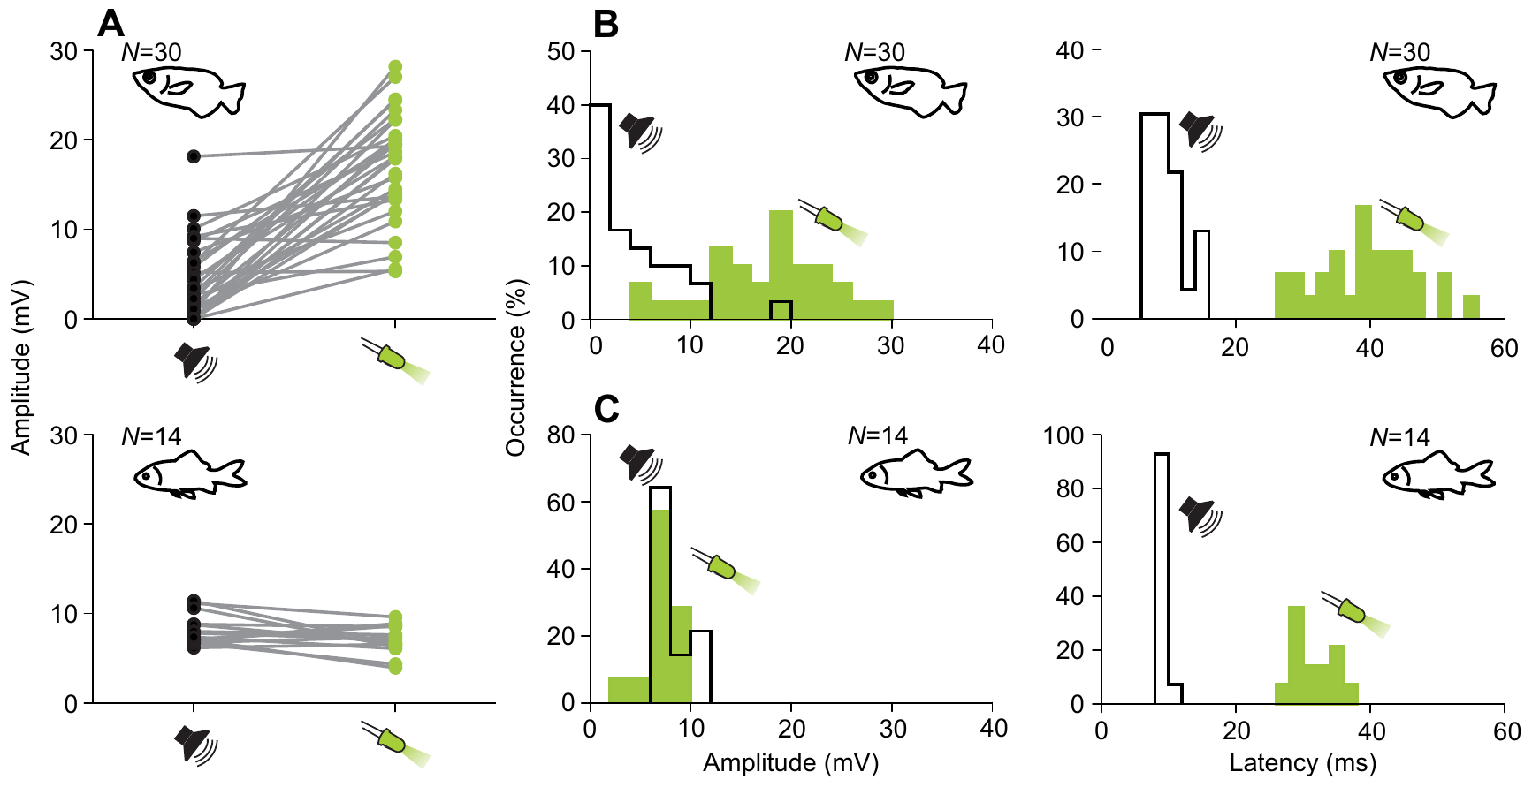
Light flashes evoke stronger but later visual inputs
Machnik and colleagues presented 7-ms light flashes while recording the same identified Mauthner cells. Visual PSP amplitudes ranged from 5.3 to 28.2 mV, with a mean of 17.1 mV. Onset latencies ranged from 27.5 to 54.2 ms, averaging 39.4 ms.
Under the tested conditions, visual responses were substantially larger than acoustic responses in archerfish. Goldfish instead had mean visual and acoustic amplitudes of 7.0 and 8.2 mV. The shared stimuli make this a comparison of relative efficacy rather than an uncontrolled comparison of separate experiments.
The late portions of the visual PSPs varied more than their initial rise, consistent with additional network input. Larger but delayed visual input fits a pathway with more processing stages before the Mauthner cell.
Machnik et al. (2018b), Fig. 5(A–C). Visual and acoustic PSP amplitude and latency comparisons.
Machnik et al. (2018a), Fig. 5(A–E). Published cell reconstructions and soma/dendrite comparisons.
Machnik et al. (2018b)
35
Notes:
• Machnik and colleagues presented 7-ms light flashes while recording the same identified Mauthner cells. Visual PSP amplitudes ranged from 5.3 to 28.2 mV, with a mean of 17.1 mV. Onset latencies ranged from 27.5 to 54.2 ms, averaging 39.4 ms.
– The flashes had an intensity of 100 cd/m² with maximum intensity at 569 nm. Species differences apply to this selected visual and acoustic comparison.
• Under the tested conditions, visual responses were substantially larger than acoustic responses in archerfish. Goldfish instead had mean visual and acoustic amplitudes of 7.0 and 8.2 mV. The shared stimuli make this a comparison of relative efficacy rather than an uncontrolled comparison of separate experiments.
• The late portions of the visual PSPs varied more than their initial rise, consistent with additional network input. Larger but delayed visual input fits a pathway with more processing stages before the Mauthner cell.
References:
Machnik P, Leupolz K, Feyl S, Schulze W, Schuster S (2018b). The Mauthner cell in a fish with top-performance and yet flexibly-tuned C-starts II. Physiology. Journal of Experimental Biology 221: jeb.175588. https://doi.org/10.1242/jeb.175588
Machnik P, Leupolz K, Feyl S, Schulze W, Schuster S (2018a). The Mauthner cell in a fish with top-performance and yet flexibly-tuned C-starts I. Identification and comparative morphology. Journal of Experimental Biology 221: jeb.182535. https://doi.org/10.1242/jeb.182535
Figure: Machnik et al. (2018b), Fig. 5(A–C). Visual and acoustic PSP amplitude and latency comparisons.
Figure source: https://doi.org/10.1242/jeb.175588
Figure: Machnik et al. (2018a), Fig. 5(A–E). Published cell reconstructions and soma/dendrite comparisons.
Figure source: https://doi.org/10.1242/jeb.182535

Slide 48
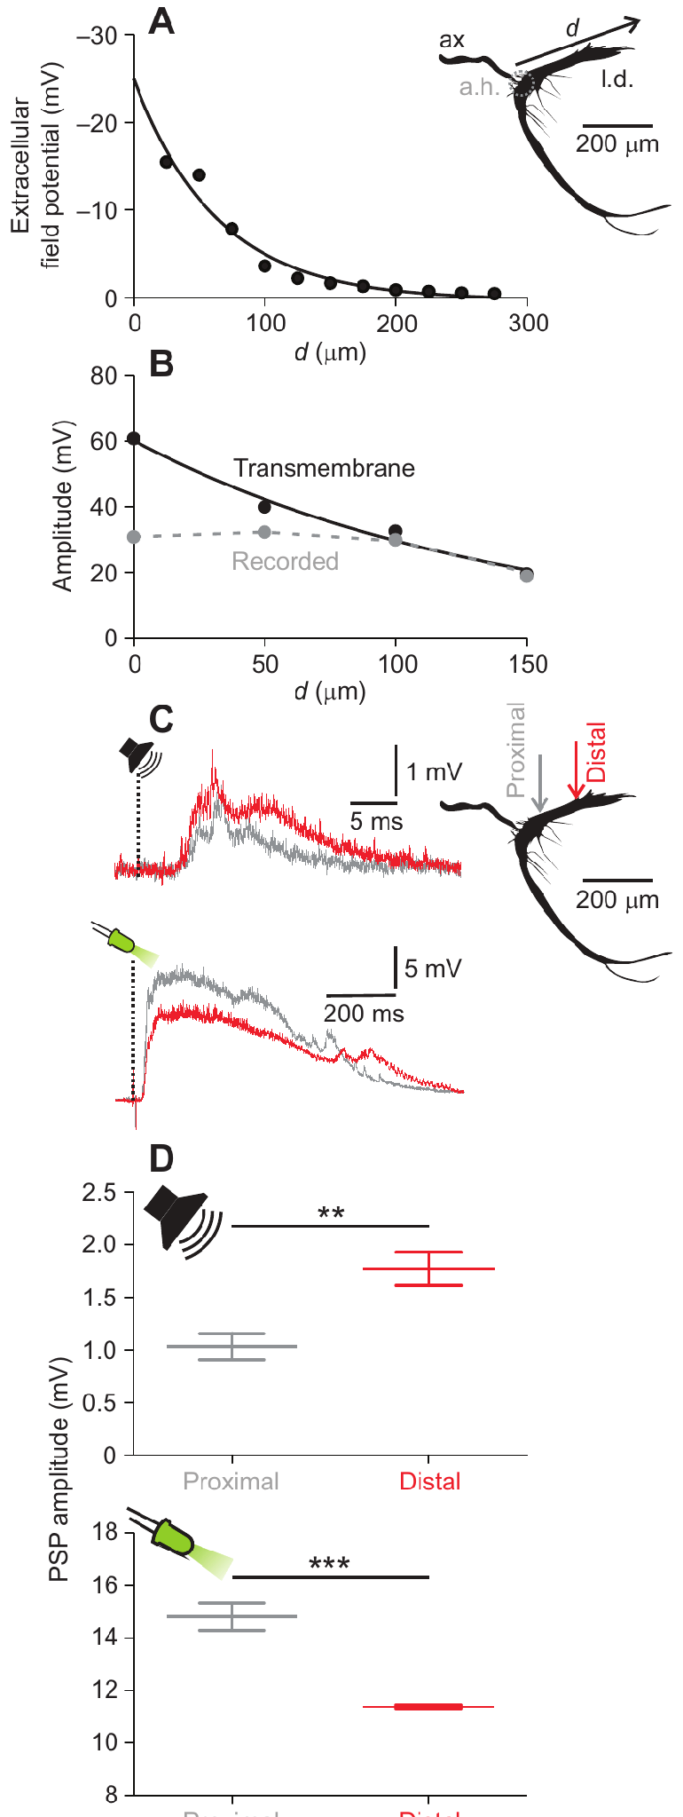
Dendritic decay separates visual from acoustic entry sites
Machnik and colleagues recorded at different positions along the Mauthner lateral dendrite and corrected the signals for the nearby extracellular field. Reconstructed spike amplitude decayed passively with length constants of 141–164 µm in the tested cells.
Acoustic PSPs were larger at a distal lateral-dendrite position than close to the soma, consistent with input arriving laterally. Visual PSPs showed the opposite gradient: their amplitude decreased toward the distal lateral dendrite, consistent with input entering nearer the soma or through another dendritic region.
Passive decay with distance means that a signal arriving far from the soma shrinks before it reaches the spike-initiation region, so the amplitude gradient indicates where an input entered.
Machnik et al. (2018b), Fig. 6(A–D). Passive dendritic decay and locations of sensory input.
Machnik et al. (2018a), Fig. 5(A–E). Published cell reconstructions and soma/dendrite comparisons.
Machnik et al. (2018b)
36
Notes:
• Machnik and colleagues recorded at different positions along the Mauthner lateral dendrite and corrected the signals for the nearby extracellular field. Reconstructed spike amplitude decayed passively with length constants of 141–164 µm in the tested cells.
– Proximal and distal recordings were approximately 50 and 150 µm lateral to the axon hillock. Different gradients are interpreted using independently measured passive decay.
• Acoustic PSPs were larger at a distal lateral-dendrite position than close to the soma, consistent with input arriving laterally. Visual PSPs showed the opposite gradient: their amplitude decreased toward the distal lateral dendrite, consistent with input entering nearer the soma or through another dendritic region.
• Passive decay with distance means that a signal arriving far from the soma shrinks before it reaches the spike-initiation region, so the amplitude gradient indicates where an input entered.
References:
Machnik P, Leupolz K, Feyl S, Schulze W, Schuster S (2018b). The Mauthner cell in a fish with top-performance and yet flexibly-tuned C-starts II. Physiology. Journal of Experimental Biology 221: jeb.175588. https://doi.org/10.1242/jeb.175588
Machnik P, Leupolz K, Feyl S, Schulze W, Schuster S (2018a). The Mauthner cell in a fish with top-performance and yet flexibly-tuned C-starts I. Identification and comparative morphology. Journal of Experimental Biology 221: jeb.182535. https://doi.org/10.1242/jeb.182535
Figure: Machnik et al. (2018b), Fig. 6(A–D). Passive dendritic decay and locations of sensory input.
Figure source: https://doi.org/10.1242/jeb.175588
Figure: Machnik et al. (2018a), Fig. 5(A–E). Published cell reconstructions and soma/dendrite comparisons.
Figure source: https://doi.org/10.1242/jeb.182535

Slide 49
A length constant measures passive decay
A length constant describes the distance over which passive voltage spread along a dendrite is attenuated. A short length constant means that a signal fades quickly with distance from the place where it entered. Distance along the dendrite is the variable that these recordings sample.
Machnik and colleagues recorded at different positions along the Mauthner lateral dendrite and corrected the signals for the nearby extracellular field. Reconstructed spike amplitude decayed passively with length constants of 141–164 µm in the tested cells.
Acoustic PSPs were larger at a distal lateral-dendrite position than close to the soma, whereas visual PSPs decreased toward the distal dendrite. The opposite gradients place the entry sites of the two inputs at different dendritic locations.
Machnik et al. (2018b), Fig. 6(A–D). Passive dendritic decay and locations of sensory input.
Machnik et al. (2018a), Fig. 5(A–E). Published cell reconstructions and soma/dendrite comparisons.
Machnik et al. (2018b); Machnik et al. (2018a)
36a
Notes:
• Passive decay allows amplitude at a recording site to report where an input entered.
• Definition.
– A length constant is the distance over which passive voltage spread is attenuated.
– A short value means a signal fades quickly.
• Recordings.
– Machnik and colleagues recorded at several positions along the lateral dendrite.
– They corrected the signals for the nearby extracellular field.
• Values.
– Reconstructed spike amplitude decayed with length constants of 141–164 micrometers.
• Acoustic input.
– Acoustic PSPs were larger at a distal lateral-dendrite position than near the soma.
– This fits input arriving laterally.
• Visual input.
– Visual PSPs showed the opposite gradient.
– Their amplitude decreased toward the distal dendrite.
• Consequence.
– The two senses enter the cell at different dendritic locations.
• Link to the circuit.
– Both input types are recorded in the same identified cell.
– Their different entry sites show that the pathways reach separate dendritic regions.
• Correction for the field.
– Recorded signals were corrected for the extracellular field near the cell.
– Without the correction the spike amplitude would be misjudged.
References:
Machnik P, Leupolz K, Feyl S, Schulze W, Schuster S (2018b). The Mauthner cell in a fish with top-performance and yet flexibly-tuned C-starts II. Physiology. Journal of Experimental Biology 221: jeb.175588. https://doi.org/10.1242/jeb.175588
Machnik P, Leupolz K, Feyl S, Schulze W, Schuster S (2018a). The Mauthner cell in a fish with top-performance and yet flexibly-tuned C-starts I. Identification and comparative morphology. Journal of Experimental Biology 221: jeb.182535. https://doi.org/10.1242/jeb.182535

Slide 50
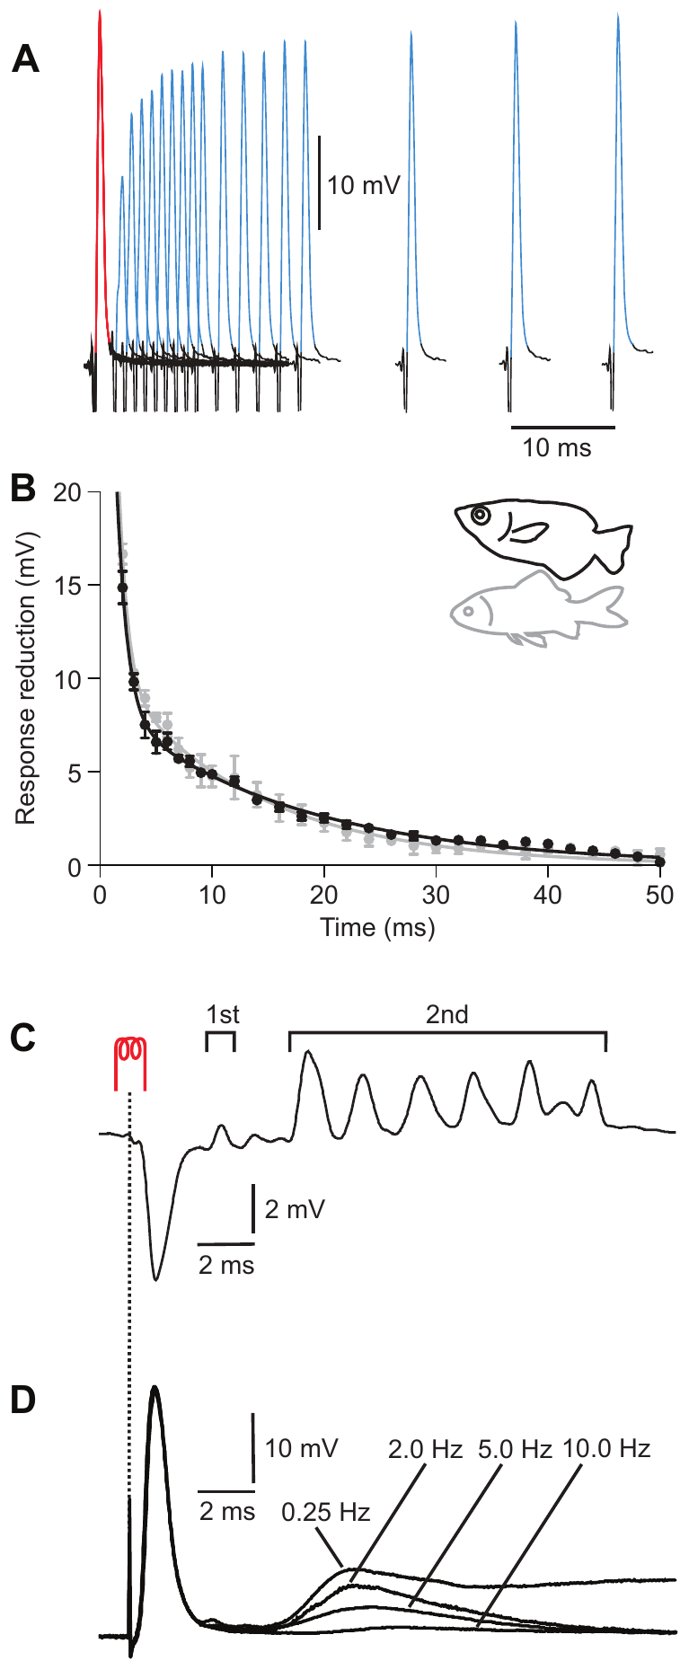
Recurrent inhibition limits repeated Mauthner firing
Recurrent inhibition is inhibitory feedback activated after a neuron or its associated network fires. Machnik and colleagues elicited pairs of antidromic Mauthner spikes and varied their separation. The second spike was reduced most strongly at short intervals, and recovery contained fast and slow components.
Archerfish recovery time constants were 0.9 and 16.5 ms, compared with 0.8 and 12.8 ms in goldfish. The paper associates the fast component provisionally with sodium-channel inactivation. Repeated stimulation and chloride-loaded recordings supplied additional tests of later inhibitory responses.
Voltage-gated sodium-channel inactivation temporarily reduces the ability to generate another spike; chloride loading can change the polarity of a chloride-dependent synaptic potential. The comparable physiology supports functionally similar inhibitory networks. Recovery with a fast and a slow component limits how quickly the cell can fire a second spike.
Machnik et al. (2018b), Fig. 7(A–D). Paired-spike tests and chloride-loaded recordings of recurrent inhibition.
Machnik et al. (2018a), Fig. 6(A–E). Hindbrain Mauthner cell and giant crossed spinal axons.
Machnik et al. (2018b)
37
Notes:
• Recurrent inhibition is inhibitory feedback activated after a neuron or its associated network fires. Machnik and colleagues elicited pairs of antidromic Mauthner spikes and varied their separation. The second spike was reduced most strongly at short intervals, and recovery contained fast and slow components.
– The chloride-loaded electrode contained 3 mol/L KCl. A change in apparent potential polarity after chloride loading must not be mistaken for a change from inhibitory to excitatory network function.
• Archerfish recovery time constants were 0.9 and 16.5 ms, compared with 0.8 and 12.8 ms in goldfish. The paper associates the fast component provisionally with sodium-channel inactivation. Repeated stimulation and chloride-loaded recordings supplied additional tests of later inhibitory responses.
• Voltage-gated sodium-channel inactivation temporarily reduces the ability to generate another spike; chloride loading can change the polarity of a chloride-dependent synaptic potential. The comparable physiology supports functionally similar inhibitory networks. Recovery with a fast and a slow component limits how quickly the cell can fire a second spike.
References:
Machnik P, Leupolz K, Feyl S, Schulze W, Schuster S (2018b). The Mauthner cell in a fish with top-performance and yet flexibly-tuned C-starts II. Physiology. Journal of Experimental Biology 221: jeb.175588. https://doi.org/10.1242/jeb.175588
Machnik P, Leupolz K, Feyl S, Schulze W, Schuster S (2018a). The Mauthner cell in a fish with top-performance and yet flexibly-tuned C-starts I. Identification and comparative morphology. Journal of Experimental Biology 221: jeb.182535. https://doi.org/10.1242/jeb.182535
Figure: Machnik et al. (2018b), Fig. 7(A–D). Paired-spike tests and chloride-loaded recordings of recurrent inhibition.
Figure source: https://doi.org/10.1242/jeb.175588
Figure: Machnik et al. (2018a), Fig. 6(A–E). Hindbrain Mauthner cell and giant crossed spinal axons.
Figure source: https://doi.org/10.1242/jeb.182535

Slide 51
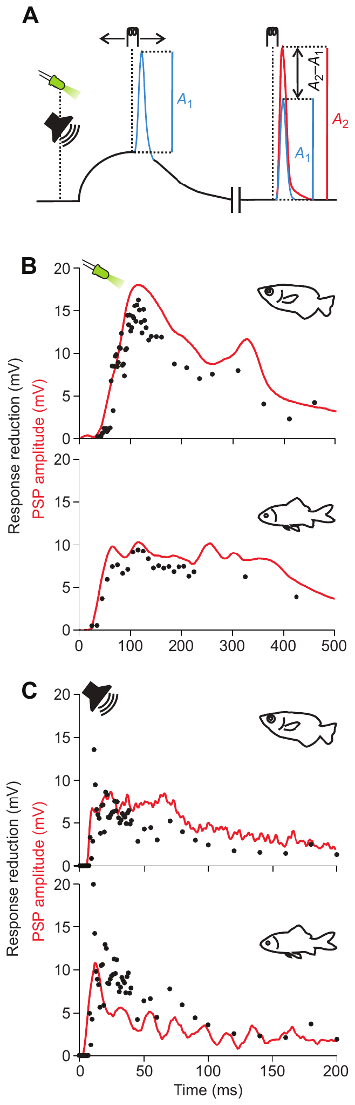
Sensory input recruits inhibition as well as excitation
Feed-forward inhibition occurs when sensory input excites inhibitory pathways alongside the pathway to a target neuron. Machnik and colleagues elicited an antidromic spike at different times during a visual or acoustic PSP, using its reduction as a probe of sensory-driven inhibition.
In archerfish and goldfish, the inhibitory time course was matched to the duration of the evoked PSP. Comparable effects occurred for visual and acoustic stimulation. Sensory access to the Mauthner cell therefore includes opposing influences rather than a purely excitatory command.
The reduction of an antidromic spike during a PSP measures a functional inhibitory effect. Matching time courses in the two species make a shared inhibitory network the parsimonious explanation.
Machnik et al. (2018b), Fig. 8(A–C). Sensory-driven inhibition measured during visual and acoustic PSPs.
Machnik et al. (2018a), Fig. 5(A–E). Published cell reconstructions and soma/dendrite comparisons.
Machnik et al. (2018b)
38
Notes:
• Feed-forward inhibition occurs when sensory input excites inhibitory pathways alongside the pathway to a target neuron. Machnik and colleagues elicited an antidromic spike at different times during a visual or acoustic PSP, using its reduction as a probe of sensory-driven inhibition.
– A sensory PSP and inhibition can overlap in time. Reduction of the probe spike is an operational measurement of that inhibition, not a direct recording from the interneurons supplying it.
• In archerfish and goldfish, the inhibitory time course was matched to the duration of the evoked PSP. Comparable effects occurred for visual and acoustic stimulation. Sensory access to the Mauthner cell therefore includes opposing influences rather than a purely excitatory command.
• The reduction of an antidromic spike during a PSP measures a functional inhibitory effect. Matching time courses in the two species make a shared inhibitory network the parsimonious explanation.
References:
Machnik P, Leupolz K, Feyl S, Schulze W, Schuster S (2018b). The Mauthner cell in a fish with top-performance and yet flexibly-tuned C-starts II. Physiology. Journal of Experimental Biology 221: jeb.175588. https://doi.org/10.1242/jeb.175588
Machnik P, Leupolz K, Feyl S, Schulze W, Schuster S (2018a). The Mauthner cell in a fish with top-performance and yet flexibly-tuned C-starts I. Identification and comparative morphology. Journal of Experimental Biology 221: jeb.182535. https://doi.org/10.1242/jeb.182535
Figure: Machnik et al. (2018b), Fig. 8(A–C). Sensory-driven inhibition measured during visual and acoustic PSPs.
Figure source: https://doi.org/10.1242/jeb.175588
Figure: Machnik et al. (2018a), Fig. 5(A–E). Published cell reconstructions and soma/dendrite comparisons.
Figure source: https://doi.org/10.1242/jeb.182535

Slide 52
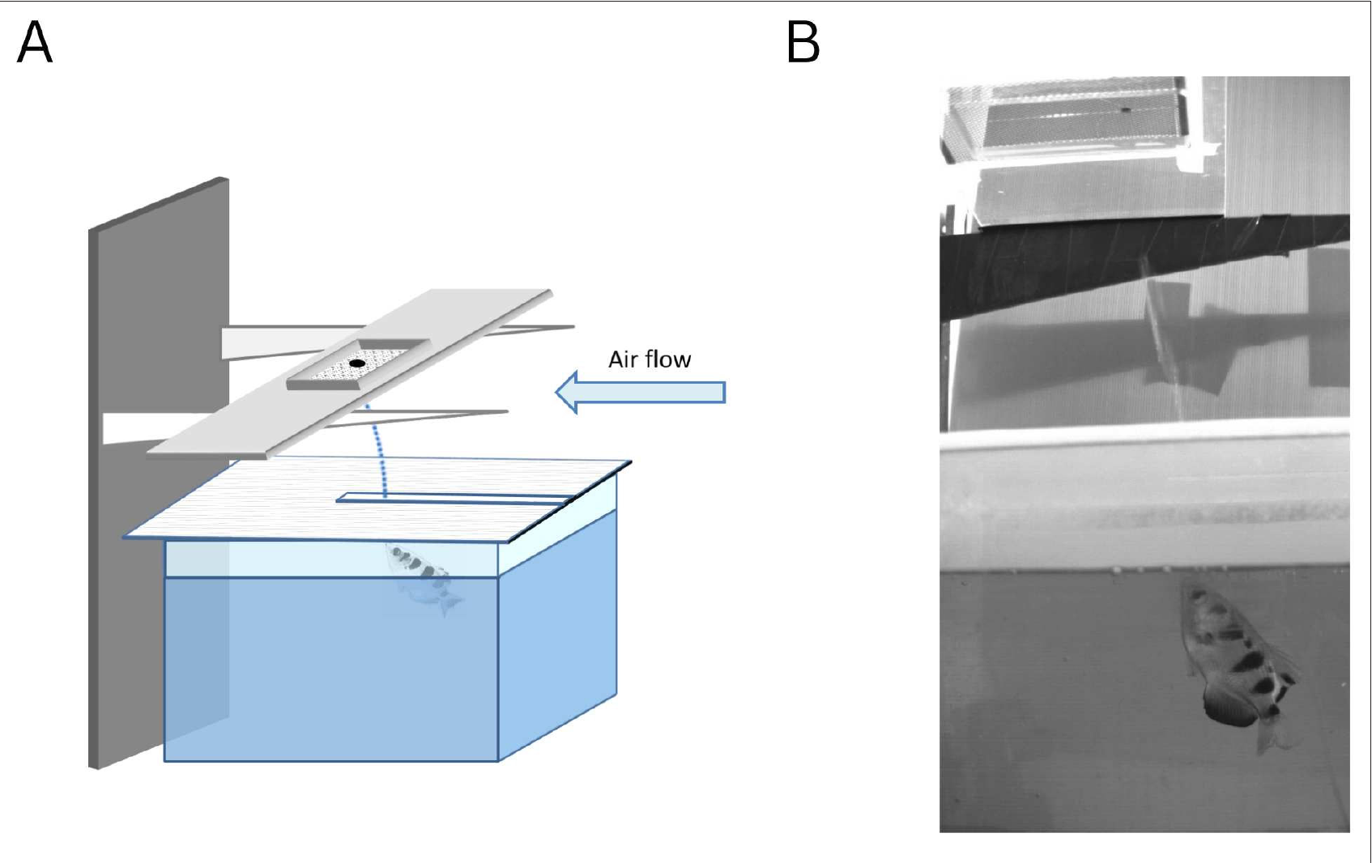
Airflow perturbation tests adaptation of shooting aim
Volotsky and colleagues trained Toxotes chatareus to shoot at an aerial target and introduced horizontal airflow above the water. The air deflected the jet while the fish remained in the water, creating an aiming error without moving the visible target itself. The fish was trained to hit a target that the airflow displaced only through its effect on the jet.
The experiment compared baseline shots, a perturbation period and shots after the airflow was removed. Errors initially increased when the airflow began and then declined over successive shots. Trials in both airflow directions showed that the adjustment applies to either direction of physical deflection. The trials in the two airflow directions were analyzed separately, so each direction has its own error sequence.
Motor adaptation is the adjustment of a movement in response to systematic errors caused by changed conditions. The measured correction shows flexible calibration of the shooting action, and the declining errors over successive shots show that the fish recalibrates each shot using the outcome of earlier shots. The adjustment therefore carries information from one shot to the next.
Volotsky et al. (2023), Fig. 2(A–B). Original airflow apparatus and photographed water jet.
Volotsky et al. (2023)
39
Notes:
• Volotsky and colleagues trained Toxotes chatareus to shoot at an aerial target and introduced horizontal airflow above the water. The air deflected the jet while the fish remained in water, creating an aiming error without moving the visible target itself.
– The published setup includes a real video frame of the water jet. Airflow acted on the aerial water stream while the target location remained controlled.
• The experiment compared baseline shots, a perturbation period, and shots after airflow removal. Errors initially increased when airflow began, then declined over successive shots. Trials in both airflow directions tested whether adjustment was limited to a single direction of physical deflection.
• Motor adaptation is adjustment of a movement in response to systematic errors caused by changed conditions. The measured correction supports flexible calibration of the shooting action. Declining errors over successive shots show that the fish recalibrate the shot using the outcome of earlier shots.
References:
Volotsky S, Donchin O, Segev R (2023). The archerfish uses motor adaptation in shooting to correct for changing physical conditions. eLife (reviewed preprint) 12: RP92909. https://doi.org/10.7554/elife.92909
Figure: Volotsky et al. (2023), Fig. 2(A–B). Original airflow apparatus and photographed water jet.
Figure source: https://doi.org/10.7554/elife.92909

Slide 53
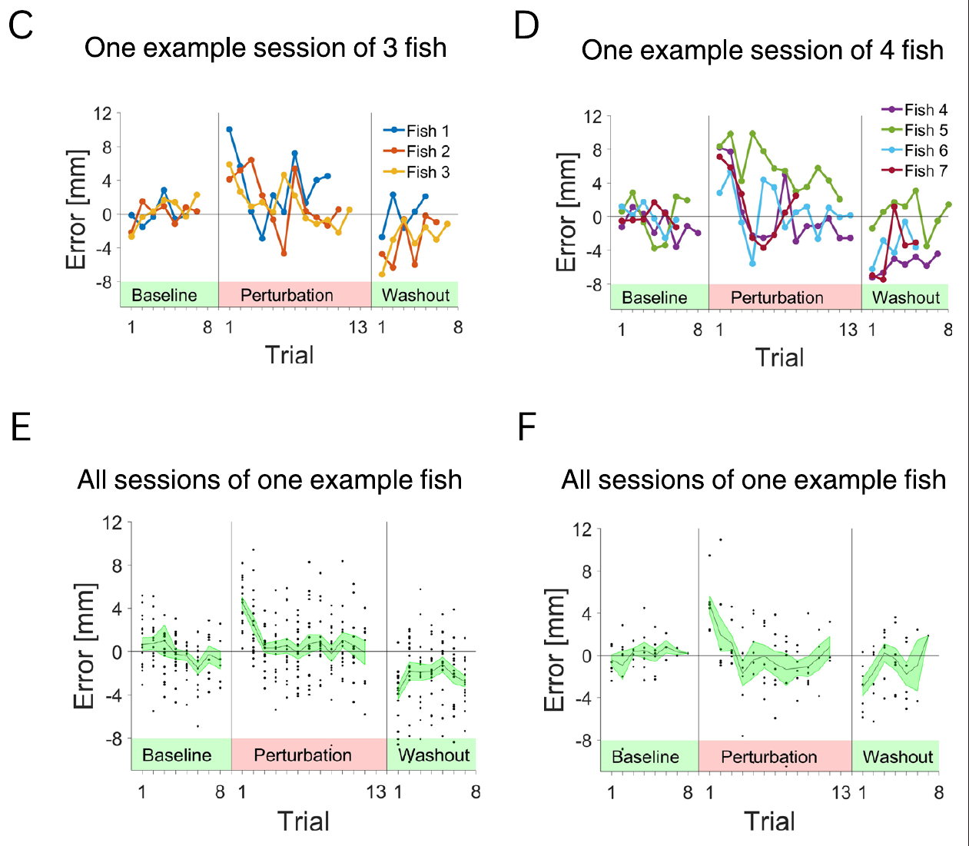
Opposite washout errors reveal retained compensation
After the airflow perturbation ended, Volotsky and colleagues observed errors in the opposite direction. These aftereffects declined over several subsequent shots. A compensation learned during the perturbation therefore initially persisted when the physical deflection was removed.
The baseline–perturbation–washout sequence distinguishes adaptive recalibration from simply following the current disturbance. If each shot only corrected the visible outcome after it occurred, removal of the disturbance would not produce the same systematic initial bias in the opposite direction.
The result supports altered motor commands anticipating a recurring perturbation. Aftereffects that decline over several shots show the compensation being unlearned as the original conditions return.
Volotsky et al. (2023), Fig. 3(C–F). Trial-by-trial error reduction and aftereffects in both airflow directions.
Volotsky et al. (2023)
40
Notes:
• After the airflow perturbation ended, Volotsky and colleagues observed errors in the opposite direction. These aftereffects declined over several subsequent shots. A compensation learned during the perturbation therefore initially persisted when the physical deflection was removed.
– Washout refers to trials after the perturbation is removed. The original error records preserve their units and condition colors, without replacing them with a simulated adaptation curve.
• The baseline–perturbation–washout sequence distinguishes adaptive recalibration from simply following the current disturbance. If each shot only corrected the visible outcome after it occurred, removal of the disturbance would not produce the same systematic initial bias in the opposite direction.
• The result supports altered motor commands anticipating a recurring perturbation. Aftereffects that decline over several shots show the compensation being unlearned as the original conditions return.
References:
Volotsky S, Donchin O, Segev R (2023). The archerfish uses motor adaptation in shooting to correct for changing physical conditions. eLife (reviewed preprint) 12: RP92909. https://doi.org/10.7554/elife.92909
Figure: Volotsky et al. (2023), Fig. 3(C–F). Trial-by-trial error reduction and aftereffects in both airflow directions.
Figure source: https://doi.org/10.7554/elife.92909

Slide 54
An aftereffect reveals retained compensation
An aftereffect is an error in the direction opposite to the original disturbance that appears when the disturbance is removed. It indicates that the movement had been recalibrated to the disturbance and is a standard signature of motor adaptation. The term applies to the first shots after the airflow stops.
Volotsky and colleagues compared baseline shots, a perturbation period of horizontal airflow, and shots after airflow removal. After the perturbation ended, errors appeared in the opposite direction and declined over several subsequent shots.
A compensation learned during the perturbation therefore initially persisted when the physical deflection was removed. If each shot only corrected the visible outcome afterward, removal of the disturbance would not produce this systematic initial bias.
Volotsky et al. (2023), Fig. 3(C–F). Trial-by-trial error reduction and aftereffects in both airflow directions.
Volotsky et al. (2023)
40a
Notes:
• The washout phase tests whether a correction was learned.
• Definition.
– An aftereffect is an error opposite to the original disturbance.
– It appears when the disturbance is removed.
• Sequence.
– Volotsky and colleagues compared baseline shots, a perturbation period and shots after airflow removal.
• Perturbation.
– Horizontal airflow deflected the jet.
– Errors increased at first and then declined over successive shots.
• Washout.
– After the airflow ended, errors appeared in the opposite direction.
– They declined over several subsequent shots.
• Interpretation.
– The compensation learned during the perturbation persisted at first.
– The shot had been recalibrated.
• Control logic.
– A fish that only corrected the visible outcome would show no systematic opposite bias.
– Motor adaptation predicts it.
• Baseline to washout.
– Baseline shots define the normal accuracy of the fish.
– The sequence from baseline through perturbation to washout separates recalibration from simple correction.
• Airflow direction.
– Trials in both airflow directions tested whether adjustment was limited to one direction of deflection.
– The target itself did not move.
References:
Volotsky S, Donchin O, Segev R (2023). The archerfish uses motor adaptation in shooting to correct for changing physical conditions. eLife (reviewed preprint) 12: RP92909. https://doi.org/10.7554/elife.92909

Slide 55
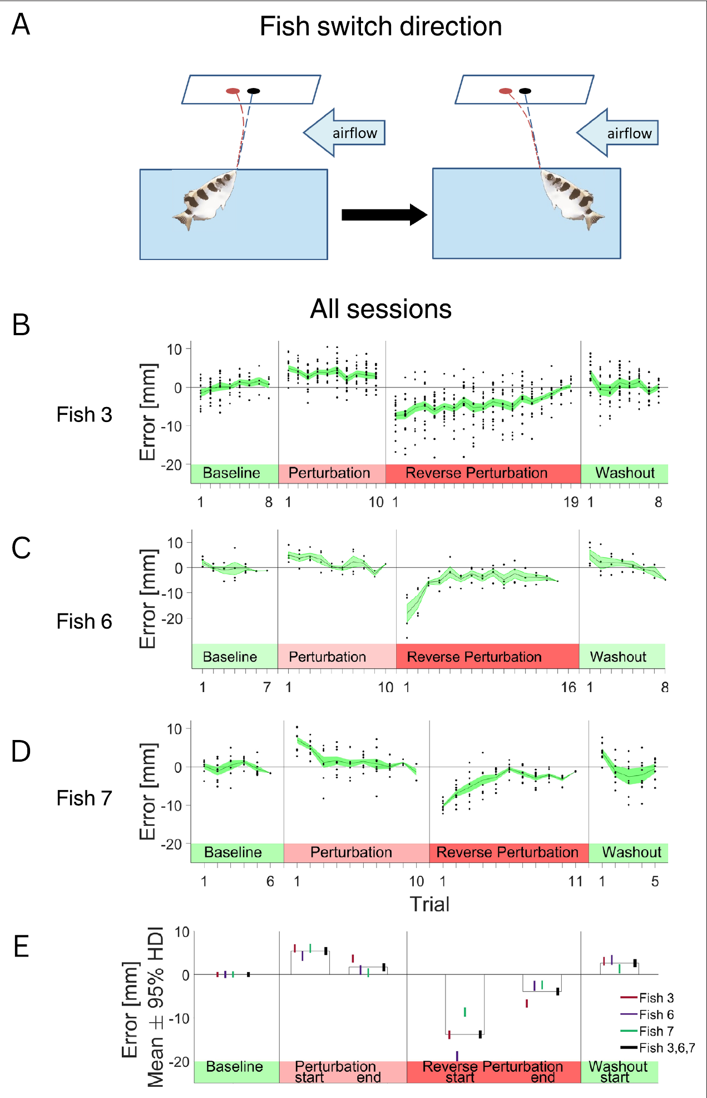
Reversing body direction reveals an egocentric adjustment
An egocentric reference frame expresses a relation relative to the animal’s body; an allocentric frame expresses it relative to the external environment. Volotsky and colleagues rotated the shooting access so a trained fish changed its body orientation while airflow direction remained fixed in the tank.
After the reversal, errors became large and adaptation required additional shots. The retained compensation followed the previous body-relative relation rather than immediately accounting for the unchanged external airflow direction. Visual landmarks within the tank remained available.
An egocentric adjustment ties the correction to the direction the fish is facing. The compensation therefore follows the body-relative relation and not the fixed airflow direction in the tank.
Volotsky et al. (2023), Fig. 5(A–E). Body-direction reversal tests of the adaptation reference frame.
Volotsky et al. (2023)
41
Notes:
• An egocentric reference frame expresses a relation relative to the animal’s body; an allocentric frame expresses it relative to the external environment. Volotsky and colleagues rotated the shooting access so a trained fish changed its body orientation while airflow direction remained fixed in the tank.
– The distinction concerns the transfer of learned correction. A fixed environmental wind becomes an opposite body-relative disturbance when the fish reverses its shooting direction.
• After the reversal, errors became large and adaptation required additional shots. The retained compensation followed the previous body-relative relation rather than immediately accounting for the unchanged external airflow direction. Visual landmarks within the tank remained available.
• An egocentric adjustment ties the correction to the direction the fish is facing. The compensation therefore follows the body-relative relation and not the fixed airflow direction in the tank.
References:
Volotsky S, Donchin O, Segev R (2023). The archerfish uses motor adaptation in shooting to correct for changing physical conditions. eLife (reviewed preprint) 12: RP92909. https://doi.org/10.7554/elife.92909
Figure: Volotsky et al. (2023), Fig. 5(A–E). Body-direction reversal tests of the adaptation reference frame.
Figure source: https://doi.org/10.7554/elife.92909

Slide 56
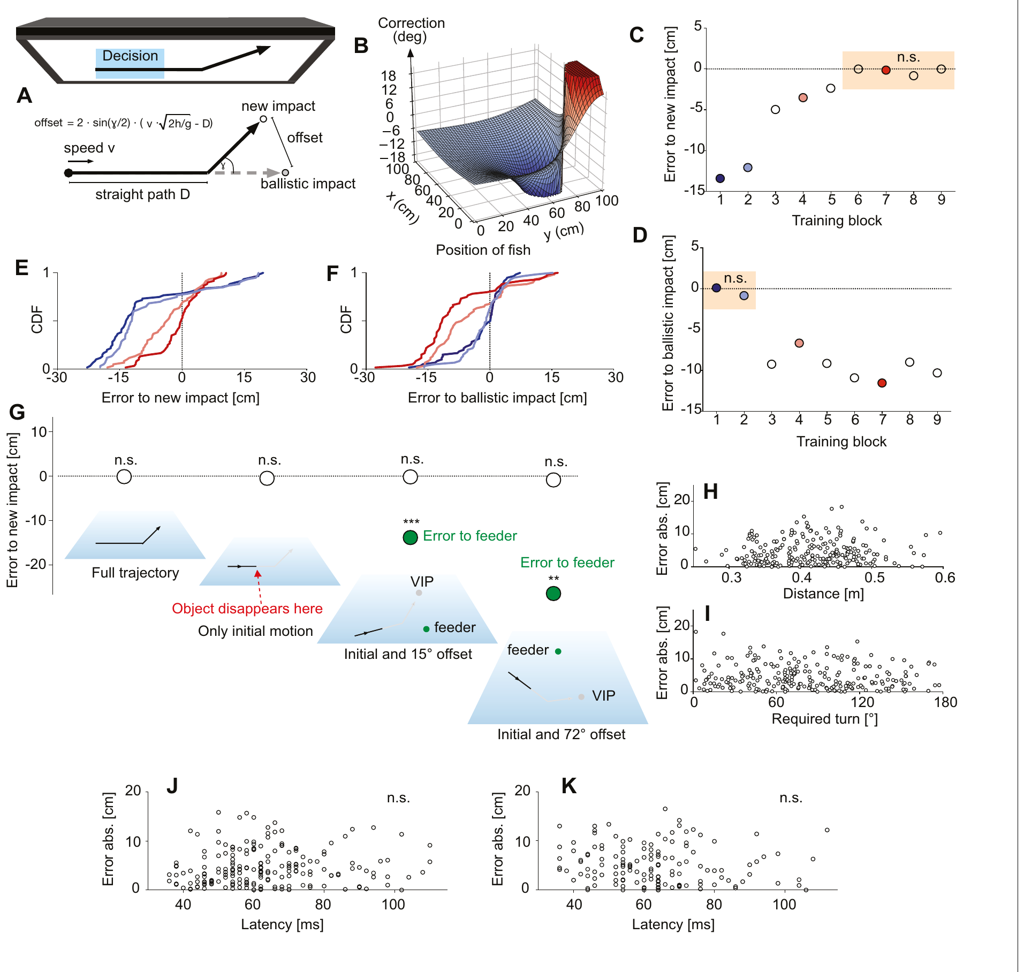
Predictive starts can learn a different interception rule
Krause and colleagues presented virtual prey on a screen above the tank and rewarded the corresponding virtual impact points. After initially straight motion, training trajectories changed direction by 39.8°. Food was then delivered at the new deflected destination rather than the old ballistic one.
With training, initial turns shifted toward the new destinations. Critical tests displayed only the early straight trajectory and moved feeders away from both candidate impact points. Fish still aimed at the learned deflected point, excluding simple pursuit of the later deflection or a visible feeder.
The response remained a rapid predictive start rather than being replaced by a slow approach. This establishes plasticity in the relation between early motion and chosen destination. The learned deflection of 39.8° became part of the mapping from early motion to destination.
Krause et al. (2024), Fig. 4(A–K). Original deflection training, transfer tests and latency–accuracy results.
Krause et al. (2024)
42
Notes:
• Krause and colleagues presented virtual prey on a screen above the tank and rewarded the corresponding virtual impact points. After initially straight motion, training trajectories changed direction by 39.8°. Food was then delivered at the new deflected destination rather than the old ballistic one.
– The virtual task retains an objective predicted landing point while allowing the investigators to change the motion-to-reward relation independently of physical falling prey.
• With training, initial turns shifted toward the new destinations. Critical tests displayed only the early straight trajectory and moved feeders away from both candidate impact points. Fish still aimed at the learned deflected point, excluding simple pursuit of the later deflection or a visible feeder.
• The response remained a rapid predictive start rather than being replaced by a slow approach. This establishes plasticity in the relation between early motion and chosen destination. The learned deflection of 39.8° became part of the mapping from early motion to destination.
References:
Krause M, Schulze W, Schuster S (2024). Learning and cognition in highspeed decision making. eLife (reviewed preprint) 13: RP99634. https://doi.org/10.7554/elife.99634
Figure: Krause et al. (2024), Fig. 4(A–K). Original deflection training, transfer tests and latency–accuracy results.
Figure source: https://doi.org/10.7554/elife.99634

Slide 57
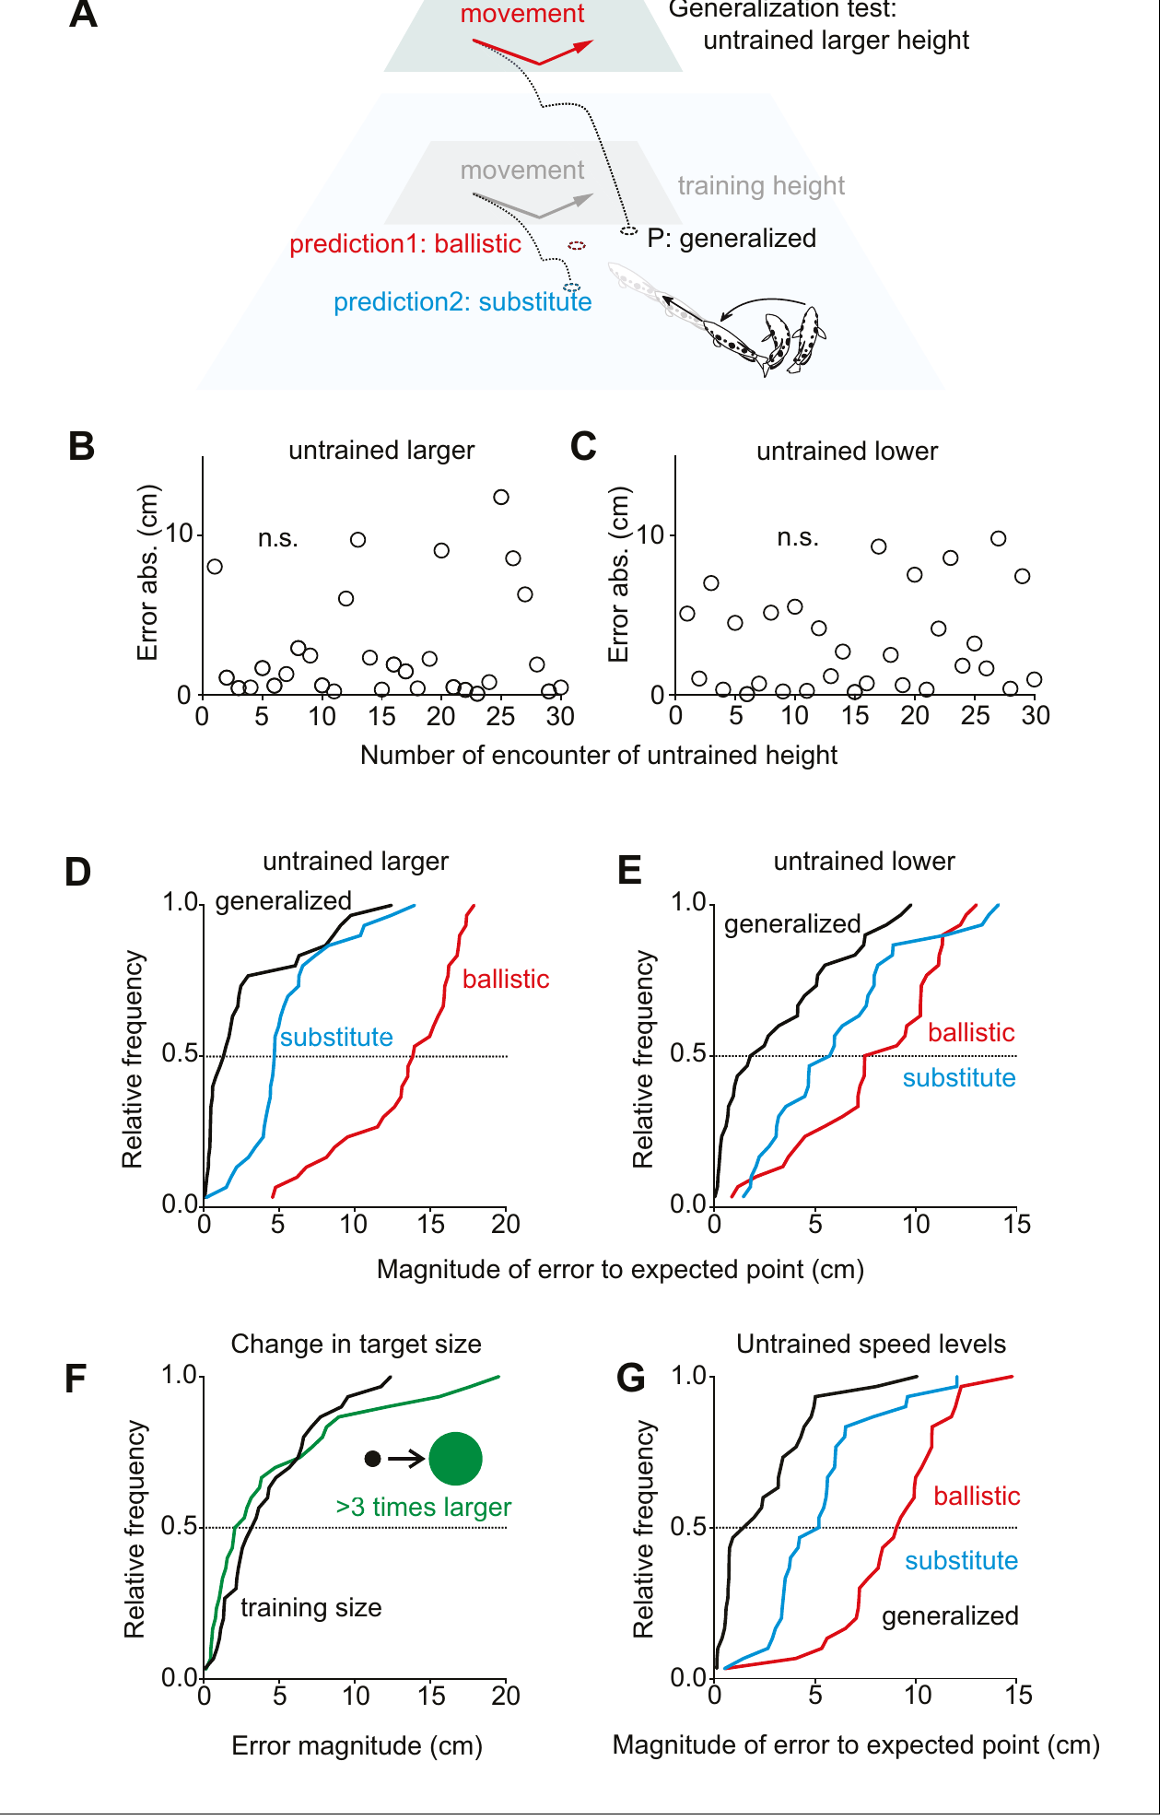
The learned rule transfers to untrained input combinations
Krause and colleagues tested whether learning only replaced familiar stimulus–response associations. Fish trained at one height were challenged at different heights where the old training-height response and the new rule predicted different destinations.
Initial turns were already appropriate for the untrained heights rather than systematically approaching the training-height substitute. Additional tests changed object size and included an untrained speed of 1.425 m/s. The learned relation generalized beyond the exact combinations repeatedly encountered during training.
Immediate transfer supports a more general representation than a lookup list restricted to trained cases. The tests used heights for which competing accounts predicted different destinations, so the initial turn identifies which relation the fish applied.
Krause et al. (2024), Fig. 5(A–G). Transfer to untrained speed, angle, size and height.
Krause et al. (2024)
43
Notes:
• Krause and colleagues tested whether learning only replaced familiar stimulus–response associations. Fish trained at one height were challenged at different heights where the old training-height response and the new rule predicted different destinations.
– Generalization means that a learned relation supports responses to inputs not previously trained. The tests were selected so alternative stored associations predicted different initial headings.
• Initial turns were already appropriate for the untrained heights rather than systematically approaching the training-height substitute. Additional tests changed object size and included an untrained speed of 1.425 m/s. The learned relation generalized beyond the exact combinations repeatedly encountered during training.
• Immediate transfer supports a more general representation than a lookup list restricted to trained cases. The tests used heights for which competing accounts predicted different destinations, so the initial turn identifies which relation the fish applied.
References:
Krause M, Schulze W, Schuster S (2024). Learning and cognition in highspeed decision making. eLife (reviewed preprint) 13: RP99634. https://doi.org/10.7554/elife.99634
Figure: Krause et al. (2024), Fig. 5(A–G). Transfer to untrained speed, angle, size and height.
Figure source: https://doi.org/10.7554/elife.99634

Slide 58
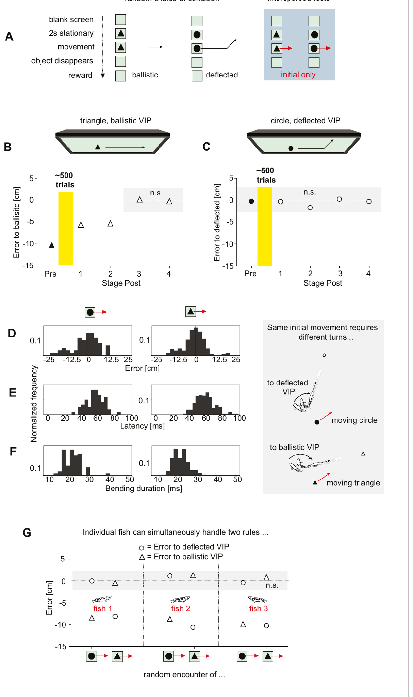
Object shape selects between two interception rules
Krause and colleagues trained fish with two visually different prey objects. A disk required the learned deflected relation, whereas a triangle required the original ballistic relation. Shape and initial motion were controlled so the same motion variables could require different destinations.
In interspersed tests, only the initial trajectory was visible. Fish directed turns toward the deflected virtual point for disks and the ballistic virtual point for triangles. The decision could therefore use a context cue to choose between two concurrent motion-to-destination relations.
This is stronger evidence than learning one fixed turn toward each shape, because required turns also depended on prey speed, direction, height and fish position. The same early motion thus leads to different destinations depending on the object that the fish sees.
Krause et al. (2024), Fig. 6(A–J). Shape cues select between learned and ballistic interception rules.
Krause et al. (2024)
44
Notes:
• Krause and colleagues trained fish with two visually different prey objects. A disk required the learned deflected relation, whereas a triangle required the original ballistic relation. Shape and initial motion were controlled so the same motion variables could require different destinations.
– The object cue chooses a rule, while current motion and geometry still determine the required heading. The rule is not equivalent to one fixed body turn per shape.
• In interspersed tests, only the initial trajectory was visible. Fish directed turns toward the deflected virtual point for disks and the ballistic virtual point for triangles. The decision could therefore use a context cue to choose between two concurrent motion-to-destination relations.
• This is stronger evidence than learning one fixed turn toward each shape, because required turns also depended on prey speed, direction, height and fish position. The same early motion thus leads to different destinations depending on the object that the fish sees.
References:
Krause M, Schulze W, Schuster S (2024). Learning and cognition in highspeed decision making. eLife (reviewed preprint) 13: RP99634. https://doi.org/10.7554/elife.99634
Figure: Krause et al. (2024), Fig. 6(A–J). Shape cues select between learned and ballistic interception rules.
Figure source: https://doi.org/10.7554/elife.99634

Slide 59
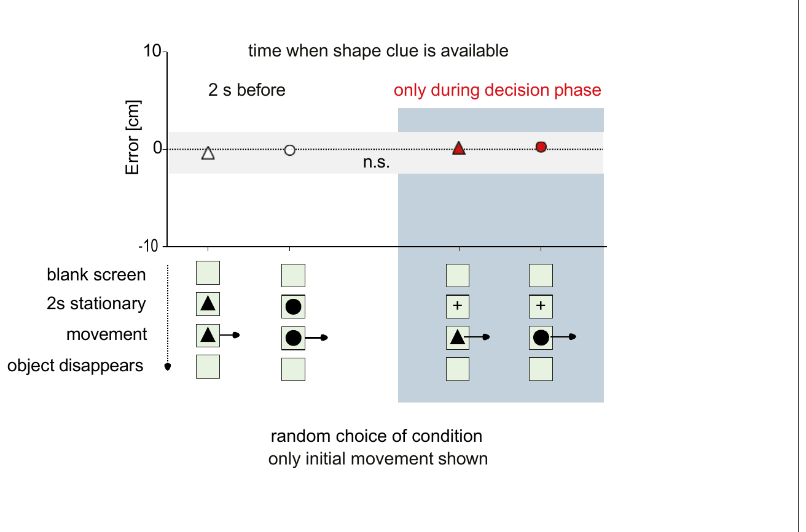
A late shape cue can still select the correct rule
Krause and colleagues tested whether a shape cue had to appear before prey motion to prepare the appropriate decision. A neutral cross remained stationary for 2 seconds, then changed into the relevant disk or triangle exactly when movement began.
Only the initial straight movement was displayed, preventing the later deflection from identifying the correct destination. Errors were comparable with those obtained when object identity had been visible 2 seconds before motion. The fish selected the appropriate rule during the brief decision interval itself.
This finding adds conditional flexibility to a response made in less than 100 ms under the tested conditions. A rule can therefore be selected on the fly, without advance preparation, within a start that begins in under 100 ms.
Krause et al. (2024), Fig. 7(A–E). Rule selection when an object changes appearance after motion onset.
Krause et al. (2024)
45
Notes:
• Krause and colleagues tested whether a shape cue had to appear before prey motion to prepare the appropriate decision. A neutral cross remained stationary for 2 seconds, then changed into the relevant disk or triangle exactly when movement began.
– Late cue means identity becomes available at motion onset, rather than before it. The paper compares that condition with an advance cue while holding the interception rules and initial motion controlled.
• Only the initial straight movement was displayed, preventing the later deflection from identifying the correct destination. Errors were comparable with those obtained when object identity had been visible 2 seconds before motion. The fish selected the appropriate rule during the brief decision interval itself.
• This finding adds conditional flexibility to a response made in less than 100 ms under the tested conditions. A rule can therefore be selected on the fly, without advance preparation, within a start that begins in under 100 ms.
References:
Krause M, Schulze W, Schuster S (2024). Learning and cognition in highspeed decision making. eLife (reviewed preprint) 13: RP99634. https://doi.org/10.7554/elife.99634
Figure: Krause et al. (2024), Fig. 7(A–E). Rule selection when an object changes appearance after motion onset.
Figure source: https://doi.org/10.7554/elife.99634

Slide 60
Key takeaways
Prediction targets future impact Early height and horizontal motion guide the initial turn toward a landing point, including a virtual landing point when descent is prevented.
Fast starts remain flexible Predictive C-starts bend and straighten rapidly while adjusting heading and take-off speed; similar escape kinematics do not alone prove a shared command neuron.
Jet control is active Range-dependent velocity gradients, stability and mouth-opening timing focus water near impact; the tested shot chemistry and body drift do not explain the adjustment.
Timing carries retinal information First-spike population timing decodes motion velocity better than the tested rate or interval measures; biological use of the decoder remains unproven.
Neural anatomy and causation differ Archerfish have identifiable Mauthner cells with strong visual access and inhibitory controls, but these studies do not directly establish their recruitment in predictive starts.
Learning changes rapid control Shooting shows adaptive aftereffects; predictive starts can learn, generalize and select between context-dependent interception rules without abandoning rapid decisions.
Rossel et al. (2002); Wöhl & Schuster (2007); Gerullis & Schuster (2014); Kretschmer et al. (2012); Machnik et al. (2018a); Machnik et al. (2018b); Volotsky et al. (2023); Krause et al. (2024)
46
Notes:
• Prediction targets future impact. Early height and horizontal motion guide the initial turn toward a landing point, including a virtual landing point when descent is prevented.
• Fast starts remain flexible. Predictive C-starts bend and straighten rapidly while adjusting heading and take-off speed; similar escape kinematics do not alone prove a shared command neuron.
• Jet control is active. Range-dependent velocity gradients, stability and mouth-opening timing focus water near impact; the tested shot chemistry and body drift do not explain the adjustment.
• Timing carries retinal information. First-spike population timing decodes motion velocity better than the tested rate or interval measures; biological use of the decoder remains unproven.
• Neural anatomy and causation differ. Archerfish have identifiable Mauthner cells with strong visual access and inhibitory controls, but these studies do not directly establish their recruitment in predictive starts.
• Learning changes rapid control. Shooting shows adaptive aftereffects; predictive starts can learn, generalize and select between context-dependent interception rules without abandoning rapid decisions.
References:
Rossel S, Corlija J, Schuster S (2002). Predicting three-dimensional target motion: how archer fish determine where to catch their dislodged prey. Journal of Experimental Biology 205: 3321-3326. https://doi.org/10.1242/jeb.205.21.3321
Wöhl S, Schuster S (2007). The predictive start of hunting archer fish: a flexible and precise motor pattern performed with the kinematics of an escape C-start. Journal of Experimental Biology 210: 311-324. https://doi.org/10.1242/jeb.02646
Gerullis P, Schuster S (2014). Archerfish Actively Control the Hydrodynamics of Their Jets. Current Biology 24: 2156-2160. https://doi.org/10.1016/j.cub.2014.07.059
Kretschmer V, Kretschmer F, Ahlers MT, Ammermüller J (2012). High speed coding for velocity by archerfish retinal ganglion cells. BMC Neuroscience 13: 69. https://doi.org/10.1186/1471-2202-13-69
Machnik P, Leupolz K, Feyl S, Schulze W, Schuster S (2018a). The Mauthner cell in a fish with top-performance and yet flexibly-tuned C-starts I. Identification and comparative morphology. Journal of Experimental Biology 221: jeb.182535. https://doi.org/10.1242/jeb.182535
Machnik P, Leupolz K, Feyl S, Schulze W, Schuster S (2018b). The Mauthner cell in a fish with top-performance and yet flexibly-tuned C-starts II. Physiology. Journal of Experimental Biology 221: jeb.175588. https://doi.org/10.1242/jeb.175588
Volotsky S, Donchin O, Segev R (2023). The archerfish uses motor adaptation in shooting to correct for changing physical conditions. eLife (reviewed preprint) 12: RP92909. https://doi.org/10.7554/elife.92909
Krause M, Schulze W, Schuster S (2024). Learning and cognition in highspeed decision making. eLife (reviewed preprint) 13: RP99634. https://doi.org/10.7554/elife.99634

