Slide 1

NEUR 411 · NEUROETHOLOGY · FALL 2026
Lecture 105A
Animal Cloning I: nuclear transfer, epigenetic reprogramming, embryonic development, and nervous system formation across species.
Date TBD
Jordan Lopez, Ph.D.
Professor of Neurobiology & Biomedical Engineering
Photo: Ovis aries.
Notes:
Animal Cloning I: nuclear transfer, epigenetic reprogramming, embryonic development, and nervous system formation across species.
Lecture 105A. Date TBD.
Figure: Photo: Ovis aries.
Figure source: https://www.inaturalist.org/observations/346767255
References:
Sinclair KD, Corr SA, Gutierrez CG, Fisher PA, Lee JH, Rathbone AJ, Choi I, Campbell KH, Gardner DS (2016). Healthy ageing of cloned sheep. Nature communications 7:12359. https://doi.org/10.1038/ncomms12359
Image: Photo: Ovis aries. Credit: (c) Christopher Stephens, some rights reserved (CC BY-SA). License: CC BY-SA 4.0. Source: https://www.inaturalist.org/observations/346767255

Slide 2
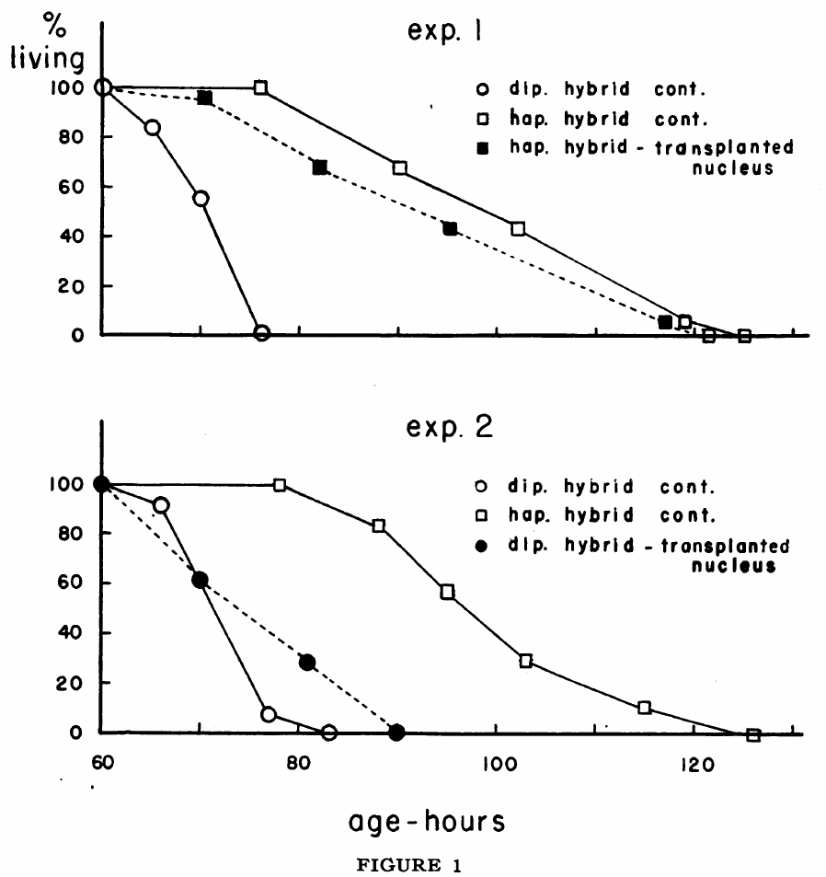

Nuclear transfer tests what a nucleus retains
Nuclear transfer places a donor nucleus inside an egg whose own nucleus has been removed. Briggs and King used nuclei from frog blastulae. A blastula is an early embryo composed of many cells. The recipient egg supplied the cytoplasm. Development therefore combined a transplanted nucleus with a new cellular environment.
The nucleus carries chromosomes, the organized DNA containing genes. Cytoplasm contains proteins and other molecules that act on those chromosomes. Removing the egg nucleus separated its chromosomes from its developmental machinery. Transplanting a nucleus restored a nuclear contribution. Subsequent cleavage tested whether that combination could resume embryonic development.
Cleavage consists of the rapid divisions that partition an early embryo. Successful cleavage required coordination between chromosomes and the recipient cytoplasm. Later development imposed additional requirements on the transplanted genome. Frog transplantation made those successive requirements experimentally separable. Developmental competence could consequently be assessed beyond the first cell division.
Briggs et al. (1952), Fig. 1. Survival after frog nuclear transplantation and genetic controls.
Photo: Lithobates pipiens. Liz Smith. CC BY 4.0.
Briggs & King (1952)
02
Notes:
• **Nuclear transfer** places a donor nucleus inside an egg whose own nucleus has been removed. Briggs and King used nuclei from frog blastulae. A blastula is an early embryo composed of many cells. The recipient egg supplied the cytoplasm. Development therefore combined a transplanted nucleus with a new cellular environment.
• The nucleus carries chromosomes, the organized DNA containing genes. Cytoplasm contains proteins and other molecules that act on those chromosomes. Removing the egg nucleus separated its chromosomes from its developmental machinery. Transplanting a nucleus restored a nuclear contribution. Subsequent cleavage tested whether that combination could resume embryonic development.
• **Cleavage** consists of the rapid divisions that partition an early embryo. Successful cleavage required coordination between chromosomes and the recipient cytoplasm. Later development imposed additional requirements on the transplanted genome. Frog transplantation made those successive requirements experimentally separable. Developmental competence could consequently be assessed beyond the first cell division.
References:
Briggs R, King TJ (1952). Transplantation of Living Nuclei From Blastula Cells into Enucleated Frogs' Eggs. Proceedings of the National Academy of Sciences of the United States of America 38(5):455-463. https://doi.org/10.1073/pnas.38.5.455
Figure: Briggs et al. (1952), Fig. 1. Survival after frog nuclear transplantation and genetic controls.
Figure source: https://doi.org/10.1073/pnas.38.5.455
Image: Photo: Lithobates pipiens. Credit: (c) Liz Smith, some rights reserved (CC BY). License: CC BY 4.0. Source: https://www.inaturalist.org/observations/16502564

Slide 3
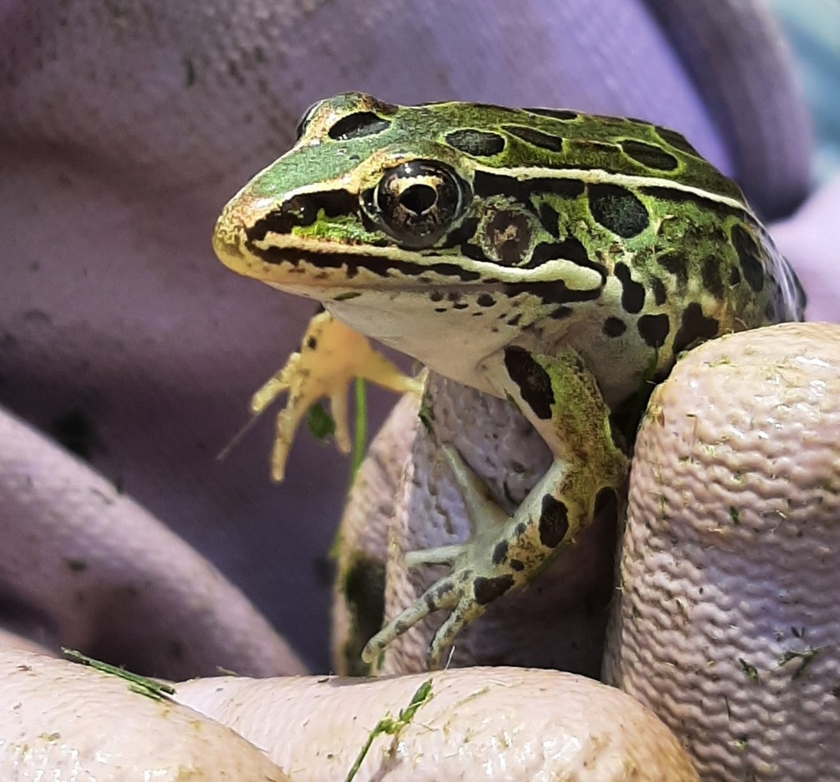
Genetic controls identify a nuclear contribution
An egg can begin dividing after experimental manipulation. Division alone therefore cannot identify which nucleus supported development. Briggs and King compared nuclear-transplant embryos with genetically informative controls. Their experiments included hybrid combinations with distinctive developmental behavior. The donor genome could then be evaluated through its consequences for development.
Haploid cells contain one chromosome set, whereas diploid cells contain two. Changing chromosome complement changes the genetic material available to the embryo. Hybrid embryos also combine contributions from different parental species. These preparations produced different survival trajectories. Nuclear transplantation could be compared against those recognizable developmental outcomes.
The survival curves follow embryos across developmental time. Their horizontal axis measures age in hours. Their vertical axis records the fraction still living. A first division and prolonged survival therefore describe different biological achievements. The genetic controls connect nuclear transplantation to the developmental properties of the transferred chromosomes.
Briggs et al. (1952), Fig. 1. Survival after frog nuclear transplantation and genetic controls.
Photo: Lithobates pipiens. Tyler Ekholm. CC BY 4.0.
Briggs & King (1952)
03
Notes:
• An egg can begin dividing after experimental manipulation. Division alone therefore cannot identify which nucleus supported development. Briggs and King compared nuclear-transplant embryos with genetically informative controls. Their experiments included hybrid combinations with distinctive developmental behavior. The donor genome could then be evaluated through its consequences for development.
• **Haploid** cells contain one chromosome set, whereas diploid cells contain two. Changing chromosome complement changes the genetic material available to the embryo. Hybrid embryos also combine contributions from different parental species. These preparations produced different survival trajectories. Nuclear transplantation could be compared against those recognizable developmental outcomes.
• The survival curves follow embryos across developmental time. Their horizontal axis measures age in hours. Their vertical axis records the fraction still living. A first division and prolonged survival therefore describe different biological achievements. The genetic controls connect nuclear transplantation to the developmental properties of the transferred chromosomes.
References:
Briggs R, King TJ (1952). Transplantation of Living Nuclei From Blastula Cells into Enucleated Frogs' Eggs. Proceedings of the National Academy of Sciences of the United States of America 38(5):455-463. https://doi.org/10.1073/pnas.38.5.455
Figure: Briggs et al. (1952), Fig. 1. Survival after frog nuclear transplantation and genetic controls.
Figure source: https://doi.org/10.1073/pnas.38.5.455
Image: Photo: Lithobates pipiens. Credit: (c) Tyler Ekholm, some rights reserved (CC BY). License: CC BY 4.0. Source: https://www.inaturalist.org/observations/87282560

Slide 4
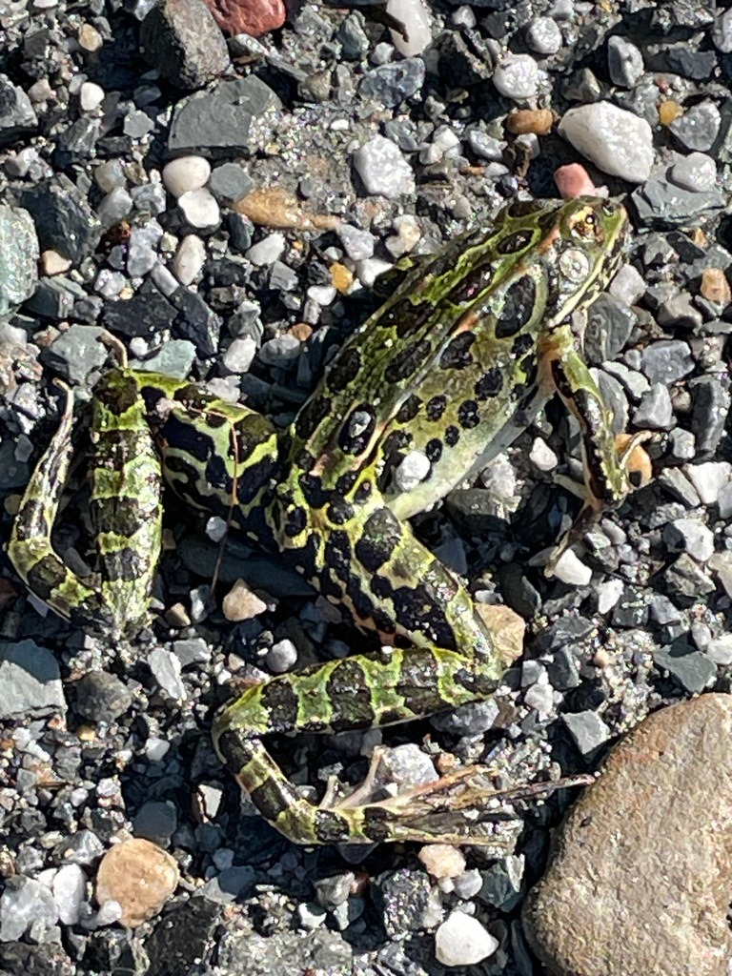
Survival extends beyond initial cleavage
Early frog development depends on more than starting a cell cycle. Transplanted nuclei must function during successive embryonic stages. Briggs and King followed embryos after the initial manipulation. Their control groups differed in chromosome complement and hybrid constitution. Survival consequently provided information that an immediate cleavage score would miss.
The published curves extend through roughly 60–130 hours of development. Embryos within different genetic preparations died at different times. Nuclear-transplant groups could be compared with the corresponding hybrid controls. Those comparisons tested the contribution of the introduced nuclear material. They connected chromosome identity with an extended developmental trajectory.
A reconstructed embryo also depends on the condition of its recipient egg. The manipulation changes both nuclear organization and the physical state of the cell. An embryo must continue dividing while organizing its tissues. Later survival therefore integrates several developmental processes. The transplantation experiments established a practical framework for following these processes separately over time.
Briggs et al. (1952), Fig. 1. Survival after frog nuclear transplantation and genetic controls.
Photo: Lithobates pipiens. Tom Scavo. CC BY 4.0.
Briggs & King (1952)
04
Notes:
• Early frog development depends on more than starting a cell cycle. Transplanted nuclei must function during successive embryonic stages. Briggs and King followed embryos after the initial manipulation. Their control groups differed in chromosome complement and hybrid constitution. Survival consequently provided information that an immediate cleavage score would miss.
• The published curves extend through roughly 60–130 hours of development. Embryos within different genetic preparations died at different times. Nuclear-transplant groups could be compared with the corresponding hybrid controls. Those comparisons tested the contribution of the introduced nuclear material. They connected chromosome identity with an extended developmental trajectory.
• A reconstructed embryo also depends on the condition of its recipient egg. The manipulation changes both nuclear organization and the physical state of the cell. An embryo must continue dividing while organizing its tissues. Later survival therefore integrates several developmental processes. The transplantation experiments established a practical framework for following these processes separately over time.
References:
Briggs R, King TJ (1952). Transplantation of Living Nuclei From Blastula Cells into Enucleated Frogs' Eggs. Proceedings of the National Academy of Sciences of the United States of America 38(5):455-463. https://doi.org/10.1073/pnas.38.5.455
Figure: Briggs et al. (1952), Fig. 1. Survival after frog nuclear transplantation and genetic controls.
Figure source: https://doi.org/10.1073/pnas.38.5.455
Image: Photo: Lithobates pipiens. Credit: (c) Tom Scavo, some rights reserved (CC BY). License: CC BY 4.0. Source: https://www.inaturalist.org/observations/191777358

Slide 5
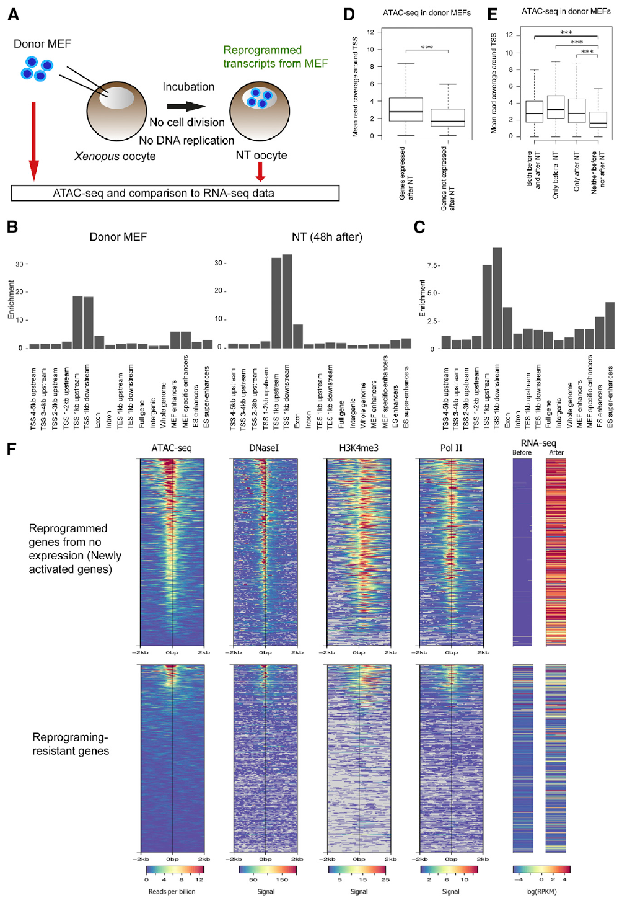
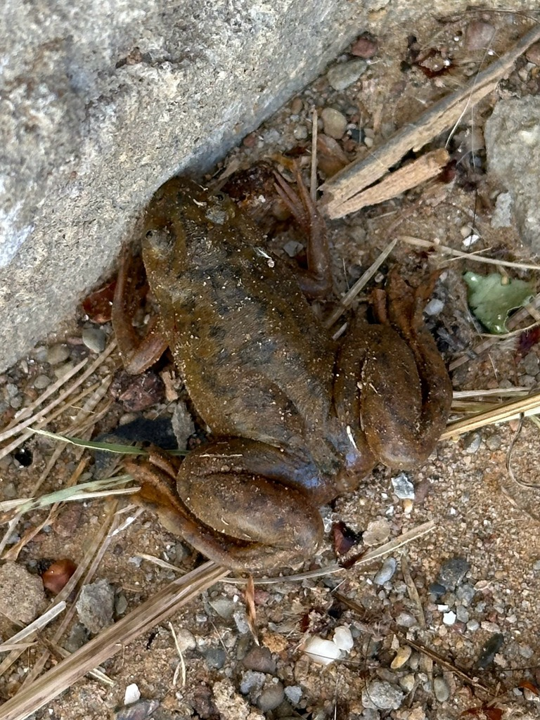
Chromatin accessibility shapes reprogramming
Chromatin is DNA packaged with associated proteins. Its organization influences whether gene-control regions are accessible. Miyamoto and colleagues examined this relationship during nuclear reprogramming in frog oocytes. They compared chromatin accessibility with transcriptional responses. Genes responded differently according to the organization of their regulatory regions.
A transcription start site is the region where production of an RNA transcript begins. Accessible start sites allow regulatory proteins to contact DNA more readily. The study measured accessibility rather than treating every donor gene as equally available. Oocyte exposure changed the transcriptional state of transplanted nuclei. The donor nucleus therefore entered reprogramming with an organized, consequential history.
Reprogramming changes the pattern of gene activity associated with a differentiated cell. It does not require replacing the entire DNA sequence. Nuclear proteins and chromatin organization can change within the recipient environment. Some genes respond more readily than others. The relationship between accessibility and transcription explains why resetting a genome is a selective molecular process.
Miyamoto et al. (2018), Fig. 2. Chromatin accessibility and transcriptional reprogramming.
Photo: Xenopus laevis. Murray Yoko. CC BY 4.0.
Miyamoto et al. (2018)
05
Notes:
• **Chromatin** is DNA packaged with associated proteins. Its organization influences whether gene-control regions are accessible. Miyamoto and colleagues examined this relationship during nuclear reprogramming in frog oocytes. They compared chromatin accessibility with transcriptional responses. Genes responded differently according to the organization of their regulatory regions.
• A **transcription start site** is the region where production of an RNA transcript begins. Accessible start sites allow regulatory proteins to contact DNA more readily. The study measured accessibility rather than treating every donor gene as equally available. Oocyte exposure changed the transcriptional state of transplanted nuclei. The donor nucleus therefore entered reprogramming with an organized, consequential history.
• **Reprogramming** changes the pattern of gene activity associated with a differentiated cell. It does not require replacing the entire DNA sequence. Nuclear proteins and chromatin organization can change within the recipient environment. Some genes respond more readily than others. The relationship between accessibility and transcription explains why resetting a genome is a selective molecular process.
References:
Miyamoto K, Nguyen KT, Allen GE, Jullien J, Kumar D, Otani T, Bradshaw CR, Livesey FJ, Kellis M, Gurdon JB (2018). Chromatin Accessibility Impacts Transcriptional Reprogramming in Oocytes. Cell reports 24(2):304-311. https://doi.org/10.1016/j.celrep.2018.06.030
Figure: Miyamoto et al. (2018), Fig. 2. Chromatin accessibility and transcriptional reprogramming.
Figure source: https://doi.org/10.1016/j.celrep.2018.06.030
Image: Photo: Xenopus laevis. Credit: (c) Murray Yoko, some rights reserved (CC BY). License: CC BY 4.0. Source: https://www.inaturalist.org/observations/406102059

Slide 6
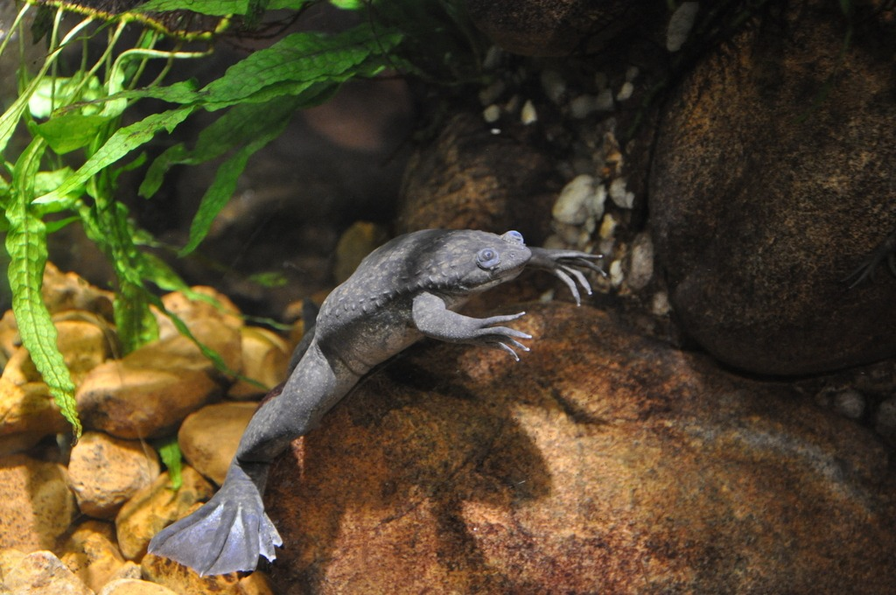
Oocyte cytoplasm changes gene activity
A differentiated cell expresses a particular subset of its genes. That expression pattern supports its specialized cellular functions. Nuclear transplantation exposes the nucleus to a different regulatory environment. Frog oocytes provide a large experimental cell for studying this response. The transplanted genome can be examined while its transcriptional state changes.
The oocyte is the female germ cell before completion of maturation. Its molecular environment differs from that of an ordinary somatic cell. Oocyte factors interact with the proteins surrounding donor DNA. Changes in chromatin accessibility accompany changes in gene expression. The experiment links a cellular environment to the activity of an introduced genome.
An accessible gene-control region and an actively transcribed gene are related measurements. They describe different steps in regulation. Accessibility concerns physical access to the DNA. Transcription concerns production of RNA from that DNA. Measuring both distinguishes the organization of a donor nucleus from the expression program it eventually adopts.
Miyamoto et al. (2018), Fig. 2. Chromatin accessibility and transcriptional reprogramming.
Photo: Xenopus laevis. Matthew Inabinett. CC BY 4.0.
Miyamoto et al. (2018)
06
Notes:
• A differentiated cell expresses a particular subset of its genes. That expression pattern supports its specialized cellular functions. Nuclear transplantation exposes the nucleus to a different regulatory environment. Frog oocytes provide a large experimental cell for studying this response. The transplanted genome can be examined while its transcriptional state changes.
• The **oocyte** is the female germ cell before completion of maturation. Its molecular environment differs from that of an ordinary somatic cell. Oocyte factors interact with the proteins surrounding donor DNA. Changes in chromatin accessibility accompany changes in gene expression. The experiment links a cellular environment to the activity of an introduced genome.
• An accessible gene-control region and an actively transcribed gene are related measurements. They describe different steps in regulation. Accessibility concerns physical access to the DNA. Transcription concerns production of RNA from that DNA. Measuring both distinguishes the organization of a donor nucleus from the expression program it eventually adopts.
References:
Miyamoto K, Nguyen KT, Allen GE, Jullien J, Kumar D, Otani T, Bradshaw CR, Livesey FJ, Kellis M, Gurdon JB (2018). Chromatin Accessibility Impacts Transcriptional Reprogramming in Oocytes. Cell reports 24(2):304-311. https://doi.org/10.1016/j.celrep.2018.06.030
Figure: Miyamoto et al. (2018), Fig. 2. Chromatin accessibility and transcriptional reprogramming.
Figure source: https://doi.org/10.1016/j.celrep.2018.06.030
Image: Photo: Xenopus laevis. Credit: (c) Matthew Inabinett, some rights reserved (CC BY). License: CC BY 4.0. Source: https://www.inaturalist.org/observations/403954636

Slide 7
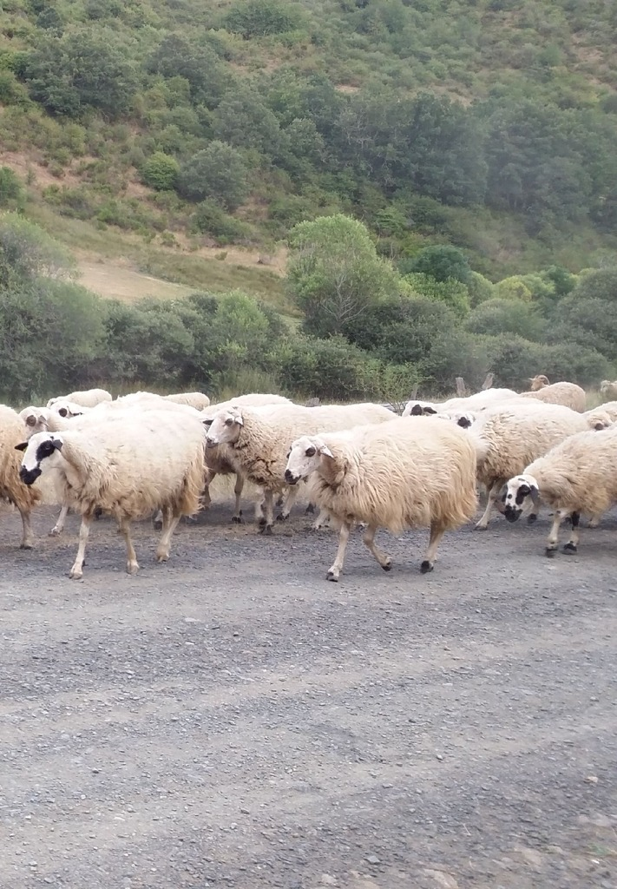
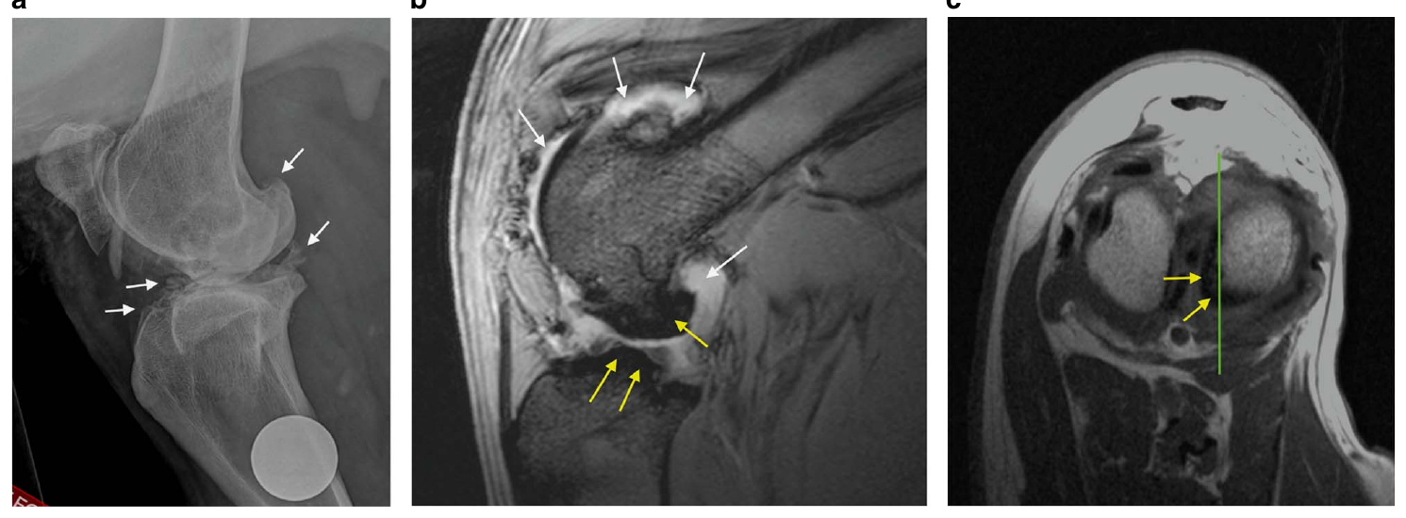
An adult nucleus can support a new sheep
Somatic cell nuclear transfer, abbreviated SCNT, uses a nucleus from a body cell. Dolly’s production established that an adult mammalian donor could support development to term. The recipient oocyte supplied the cellular environment for restarting development. Gestation then occurred in a recipient ewe. Nuclear donation and pregnancy therefore involved distinct biological contributions.
Sinclair and colleagues later examined aged sheep produced by SCNT. Their cohort included animals derived from the same cell line that produced Dolly. They assessed metabolic health, blood pressure and the musculoskeletal system. These measurements extended observation well beyond birth. The developmental outcome could be followed into the animals’ later lives.
A cell line is a population of cells maintained through growth in culture. Animals produced from the same donor line can share a nuclear genetic origin. They nevertheless develop in separate oocytes and pregnancies. Their postnatal lives also unfold separately. Studying aged clones therefore connects nuclear reprogramming with the formation and maintenance of functioning animals.
Sinclair et al. (2016), Fig. 6. Radiological and magnetic-resonance assessment of a cloned sheep joint.
Photo: Ovis aries. no rights reserved. CC0 1.0.
Sinclair et al. (2016); Wilmut et al. (1997)
07
Notes:
• **Somatic cell nuclear transfer**, abbreviated SCNT, uses a nucleus from a body cell. Dolly’s production established that an adult mammalian donor could support development to term. The recipient oocyte supplied the cellular environment for restarting development. Gestation then occurred in a recipient ewe. Nuclear donation and pregnancy therefore involved distinct biological contributions.
• Sinclair and colleagues later examined aged sheep produced by SCNT. Their cohort included animals derived from the same cell line that produced Dolly. They assessed metabolic health, blood pressure and the musculoskeletal system. These measurements extended observation well beyond birth. The developmental outcome could be followed into the animals’ later lives.
• A **cell line** is a population of cells maintained through growth in culture. Animals produced from the same donor line can share a nuclear genetic origin. They nevertheless develop in separate oocytes and pregnancies. Their postnatal lives also unfold separately. Studying aged clones therefore connects nuclear reprogramming with the formation and maintenance of functioning animals.
References:
Sinclair KD, Corr SA, Gutierrez CG, Fisher PA, Lee JH, Rathbone AJ, Choi I, Campbell KH, Gardner DS (2016). Healthy ageing of cloned sheep. Nature communications 7:12359. https://doi.org/10.1038/ncomms12359
Wilmut I, Schnieke AE, McWhir J, Kind AJ, Campbell KH (1997). Viable offspring derived from fetal and adult mammalian cells. Nature 385(6619):810-813. https://doi.org/10.1038/385810a0
Figure: Sinclair et al. (2016), Fig. 6. Radiological and magnetic-resonance assessment of a cloned sheep joint.
Figure source: https://doi.org/10.1038/ncomms12359
Image: Photo: Ovis aries. Credit: no rights reserved. License: CC0 1.0. Source: https://www.inaturalist.org/observations/409920415

Slide 8

Cloned sheep retain adult metabolic function
The aged cloned sheep were approximately 7–9 years old. Sinclair and colleagues examined how their bodies regulated glucose. Glucose is a circulating sugar used by many tissues as fuel. Insulin helps regulate glucose uptake and metabolism. The study assessed the animals’ responses rather than inferring health from appearance alone.
The sheep were euglycaemic, meaning their glucose concentrations were within the normal range. They also retained insulin sensitivity. Their blood-pressure measurements were consistent with normal regulation. These results describe specific physiological systems in surviving aged clones. They extend the assessment of SCNT outcomes beyond successful delivery and early growth.
The comparison included younger sheep and published physiological reference ranges. Different measurements addressed different aspects of health. Metabolic regulation concerns the handling of fuel. Blood pressure concerns the circulation that distributes that fuel. The combined assessments linked embryonic reprogramming with adult physiological performance across several organ systems.
Sinclair et al. (2016), Fig. 6. Radiological and magnetic-resonance assessment of a cloned sheep joint.
Photo: Ovis aries. Barney M. CC BY 4.0.
Sinclair et al. (2016); Wilmut et al. (1997)
08
Notes:
• The aged cloned sheep were approximately 7–9 years old. Sinclair and colleagues examined how their bodies regulated glucose. **Glucose** is a circulating sugar used by many tissues as fuel. **Insulin** helps regulate glucose uptake and metabolism. The study assessed the animals’ responses rather than inferring health from appearance alone.
• The sheep were euglycaemic, meaning their glucose concentrations were within the normal range. They also retained insulin sensitivity. Their blood-pressure measurements were consistent with normal regulation. These results describe specific physiological systems in surviving aged clones. They extend the assessment of SCNT outcomes beyond successful delivery and early growth.
• The comparison included younger sheep and published physiological reference ranges. Different measurements addressed different aspects of health. Metabolic regulation concerns the handling of fuel. Blood pressure concerns the circulation that distributes that fuel. The combined assessments linked embryonic reprogramming with adult physiological performance across several organ systems.
References:
Sinclair KD, Corr SA, Gutierrez CG, Fisher PA, Lee JH, Rathbone AJ, Choi I, Campbell KH, Gardner DS (2016). Healthy ageing of cloned sheep. Nature communications 7:12359. https://doi.org/10.1038/ncomms12359
Wilmut I, Schnieke AE, McWhir J, Kind AJ, Campbell KH (1997). Viable offspring derived from fetal and adult mammalian cells. Nature 385(6619):810-813. https://doi.org/10.1038/385810a0
Figure: Sinclair et al. (2016), Fig. 6. Radiological and magnetic-resonance assessment of a cloned sheep joint.
Figure source: https://doi.org/10.1038/ncomms12359
Image: Photo: Ovis aries. Credit: (c) Barney M, some rights reserved (CC BY). License: CC BY 4.0. Source: https://www.inaturalist.org/observations/197151674

Slide 9
Joint health is a developmental outcome
A functioning animal must coordinate movement with a mechanically sound skeleton. Sinclair and colleagues examined the major joints of aged cloned sheep. They included radiological examinations of the knees. Radiology uses imaging to assess structures inside the body. This approach complemented direct clinical examination of movement and joint function.
Osteoarthritis involves degenerative changes within a joint. Most abnormalities in the examined sheep were mild, although one animal had moderate changes. The investigators found no clinical signs of degenerative joint disease across the cohort. Structural observations and clinical behavior therefore supplied complementary information. An imaging abnormality and an obvious movement disorder are different outcomes.
Dolly’s history had raised questions about joint health in cloned animals. Following other animals from the same donor line allowed a broader assessment. The surviving aged sheep retained generally good musculoskeletal function. Their development had produced bodies capable of sustained movement over many years. Longitudinal health assessment consequently extends the meaning of a successful cloning outcome.
Sinclair et al. (2016), Fig. 6. Radiological and magnetic-resonance assessment of a cloned sheep joint.
Sinclair et al. (2016); Wilmut et al. (1997)
09
Notes:
• A functioning animal must coordinate movement with a mechanically sound skeleton. Sinclair and colleagues examined the major joints of aged cloned sheep. They included radiological examinations of the knees. **Radiology** uses imaging to assess structures inside the body. This approach complemented direct clinical examination of movement and joint function.
• **Osteoarthritis** involves degenerative changes within a joint. Most abnormalities in the examined sheep were mild, although one animal had moderate changes. The investigators found no clinical signs of degenerative joint disease across the cohort. Structural observations and clinical behavior therefore supplied complementary information. An imaging abnormality and an obvious movement disorder are different outcomes.
• Dolly’s history had raised questions about joint health in cloned animals. Following other animals from the same donor line allowed a broader assessment. The surviving aged sheep retained generally good musculoskeletal function. Their development had produced bodies capable of sustained movement over many years. Longitudinal health assessment consequently extends the meaning of a successful cloning outcome.
References:
Sinclair KD, Corr SA, Gutierrez CG, Fisher PA, Lee JH, Rathbone AJ, Choi I, Campbell KH, Gardner DS (2016). Healthy ageing of cloned sheep. Nature communications 7:12359. https://doi.org/10.1038/ncomms12359
Wilmut I, Schnieke AE, McWhir J, Kind AJ, Campbell KH (1997). Viable offspring derived from fetal and adult mammalian cells. Nature 385(6619):810-813. https://doi.org/10.1038/385810a0
Figure: Sinclair et al. (2016), Fig. 6. Radiological and magnetic-resonance assessment of a cloned sheep joint.
Figure source: https://doi.org/10.1038/ncomms12359

Slide 10
Nuclear origin differs from developmental age
An adult donor cell has already undergone development within its original animal. An SCNT embryo begins another developmental trajectory. The aged-sheep study followed the animals according to their own postnatal ages. Those ages were distinct from the history of the donor cell line. A shared nuclear origin therefore does not assign an animal the donor’s chronological age.
The cloned sheep underwent separate embryonic development and gestation. Their tissues grew and matured after birth. Physiological testing assessed the functioning of those newly developed tissues. The study included animals related through a common nuclear donor. Their adult health was evaluated as an outcome of their individual developmental histories.
The term phenotype means the observable characteristics of an organism. It includes physiology and behavior as well as external appearance. A cloning outcome therefore encompasses more than a DNA identity test. Metabolic responses and joint function are measurable components of phenotype. Their assessment connects the reconstituted embryo with the functioning adult animal.
Sinclair et al. (2016), Fig. 6. Radiological and magnetic-resonance assessment of a cloned sheep joint.
Sinclair et al. (2016); Wilmut et al. (1997)
10
Notes:
• An adult donor cell has already undergone development within its original animal. An SCNT embryo begins another developmental trajectory. The aged-sheep study followed the animals according to their own postnatal ages. Those ages were distinct from the history of the donor cell line. A shared nuclear origin therefore does not assign an animal the donor’s chronological age.
• The cloned sheep underwent separate embryonic development and gestation. Their tissues grew and matured after birth. Physiological testing assessed the functioning of those newly developed tissues. The study included animals related through a common nuclear donor. Their adult health was evaluated as an outcome of their individual developmental histories.
• The term **phenotype** means the observable characteristics of an organism. It includes physiology and behavior as well as external appearance. A cloning outcome therefore encompasses more than a DNA identity test. Metabolic responses and joint function are measurable components of phenotype. Their assessment connects the reconstituted embryo with the functioning adult animal.
References:
Sinclair KD, Corr SA, Gutierrez CG, Fisher PA, Lee JH, Rathbone AJ, Choi I, Campbell KH, Gardner DS (2016). Healthy ageing of cloned sheep. Nature communications 7:12359. https://doi.org/10.1038/ncomms12359
Wilmut I, Schnieke AE, McWhir J, Kind AJ, Campbell KH (1997). Viable offspring derived from fetal and adult mammalian cells. Nature 385(6619):810-813. https://doi.org/10.1038/385810a0
Figure: Sinclair et al. (2016), Fig. 6. Radiological and magnetic-resonance assessment of a cloned sheep joint.
Figure source: https://doi.org/10.1038/ncomms12359

Slide 11

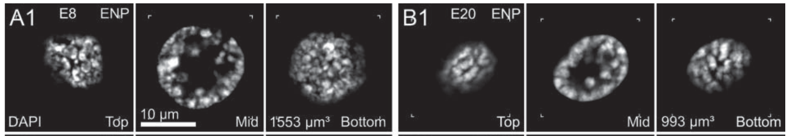

Bovine nuclei reorganize after transfer
A fibroblast nucleus is organized for the needs of a differentiated body cell. Fibroblasts are connective-tissue cells commonly used as nuclear donors. Popken and colleagues examined how their nuclei were reorganized in cloned bovine embryos. They used microscopy to follow nuclear structure. Fertilized embryos supplied a developmental reference for comparison.
DNA staining revealed the arrangement of chromatin inside each nucleus. Dense chromatin and more open nuclear regions formed different spatial patterns. Those patterns changed during early embryonic development. Reconstructed embryos therefore underwent physical nuclear remodeling as well as cell division. Reprogramming included the organization of material inside the nuclear boundary.
Three-dimensional imaging records structure through the depth of a specimen. A single optical section samples only one level of the nucleus. Multiple sections distinguish a local appearance from an extended nuclear arrangement. The study combined these views to characterize nuclear phenotypes. Nuclear transfer could consequently be assessed at the scale of chromatin architecture.
Popken et al. (2014), Fig. 1(A1, B1). Optical sections of IVF embryo nuclei at two cleavage stages, the study’s reference preparation.
Photo: Bos taurus. F. LaBry. CC BY 4.0.
Popken (2014), Supplemental Movie 1. Original three-dimensional nuclear imaging.
Popken et al. (2014)
11
Notes:
• A fibroblast nucleus is organized for the needs of a differentiated body cell. **Fibroblasts** are connective-tissue cells commonly used as nuclear donors. Popken and colleagues examined how their nuclei were reorganized in cloned bovine embryos. They used microscopy to follow nuclear structure. Fertilized embryos supplied a developmental reference for comparison.
• DNA staining revealed the arrangement of chromatin inside each nucleus. Dense chromatin and more open nuclear regions formed different spatial patterns. Those patterns changed during early embryonic development. Reconstructed embryos therefore underwent physical nuclear remodeling as well as cell division. Reprogramming included the organization of material inside the nuclear boundary.
• **Three-dimensional imaging** records structure through the depth of a specimen. A single optical section samples only one level of the nucleus. Multiple sections distinguish a local appearance from an extended nuclear arrangement. The study combined these views to characterize nuclear phenotypes. Nuclear transfer could consequently be assessed at the scale of chromatin architecture.
References:
Popken J, Brero A, Koehler D, Schmid VJ, Strauss A, Wuensch A, Guengoer T, Graf A, Krebs S, Blum H, Zakhartchenko V, Wolf E, Cremer T (2014). Reprogramming of fibroblast nuclei in cloned bovine embryos involves major structural remodeling with both striking similarities and differences to nuclear phenotypes of in vitro fertilized embryos. Nucleus (Austin, Tex.) 5(6):555-589. https://doi.org/10.4161/19491034.2014.979712
Figure: Popken et al. (2014), Fig. 1(A1, B1). Optical sections of IVF embryo nuclei at two cleavage stages, the study’s reference preparation.
Figure source: https://doi.org/10.4161/19491034.2014.979712
Image: Photo: Bos taurus. Credit: (c) F. LaBry, some rights reserved (CC BY). License: CC BY 4.0. Source: https://www.inaturalist.org/observations/410026685
Embedded video: Popken (2014), Supplemental Movie 1. Original three-dimensional nuclear imaging.
Article: Popken J, Brero A, Koehler D, Schmid VJ, Strauss A, Wuensch A, Guengoer T, Graf A, Krebs S, Blum H, Zakhartchenko V, Wolf E, Cremer T. (2014). Reprogramming of fibroblast nuclei in cloned bovine embryos involves major structural remodeling with both striking similarities and differences to nuclear phenotypes of in vitro fertilized embryos. Nucleus (Austin, Tex.) 5:555-589. https://doi.org/10.4161/19491034.2014.979712
Exact source filename: kncl-05-06-979712-s007.avi
Original media/source page: https://www.ebi.ac.uk/europepmc/webservices/rest/PMC4615760/supplementaryFiles
Original source hash: 9c12bb96cc60439285a0aa39bacf8ef81fdb830103c6b56c1e87704e082fd90e
Embedded clip hash: 19b82210975c8163d8bc2307cafa8c387fb693a6fc969adc588583f24bedaafe
Source recording interval: 0.000–137.000 s. Original scientific frames, proportions, author-provided timing and available audio retained. Playback seconds are not necessarily biological elapsed time in source time-lapse/accelerated films.
License: This is an Open Access article distributed under the terms of the Creative Commons Attribution-Non-Commercial License ( http://creativecommons.org/licenses/by-nc/3.0/ ), which permits unrestricted non-commercial use, distribution, and reproduction in any medium, provided the original work is properly cited. The moral rights of the named author(s) have been asserted.
Native PPTX movie object with a separate static poster fallback. Desktop PowerPoint GUI playback and Google Slides import have not been tested. Google Slides may require inserting the supplied MP4 from Drive after import.

Slide 12

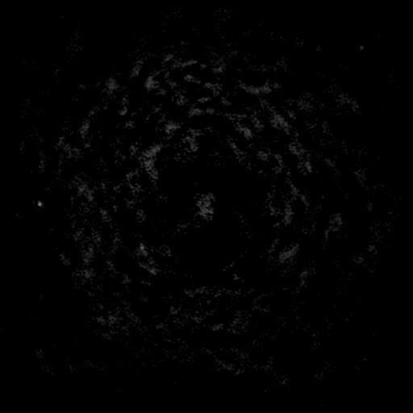
Fertilized nuclei provide a reference
An embryo produced by fertilization develops from contributions of sperm and oocyte. An SCNT embryo begins with a differentiated donor nucleus. Popken and colleagues compared the nuclear structures produced by these different routes. The comparison followed bovine preimplantation development. Preimplantation denotes the period before the embryo establishes implantation-associated contact with the uterus.
The microscopy distinguished several characteristic nuclear arrangements. Some features of cloned embryos resembled those of fertilized embryos. Other features retained a different organization. Development therefore involved convergence in some nuclear properties without uniform identity in every property. Nuclear architecture could be described in greater detail than a simple normal-or-abnormal classification.
Each reconstructed embryo contains nuclei at a particular developmental stage. Stage-matched comparisons reduce confusion between developmental progression and production method. The study followed changes across cleavage stages rather than examining only one endpoint. Nuclear phenotype consequently became a developmental trajectory. That trajectory connected the starting fibroblast nucleus with an increasingly embryonic organization.
Popken et al. (2014), Fig. 1(A1, B1). Optical sections of IVF embryo nuclei at two cleavage stages, the study’s reference preparation.
Photo: Bos taurus. Paulius Rupšas. CC BY 4.0.
Popken (2014), Supplemental Movie 2. Original three-dimensional nuclear imaging.
Popken et al. (2014)
12
Notes:
• An embryo produced by fertilization develops from contributions of sperm and oocyte. An SCNT embryo begins with a differentiated donor nucleus. Popken and colleagues compared the nuclear structures produced by these different routes. The comparison followed bovine preimplantation development. **Preimplantation** denotes the period before the embryo establishes implantation-associated contact with the uterus.
• The microscopy distinguished several characteristic nuclear arrangements. Some features of cloned embryos resembled those of fertilized embryos. Other features retained a different organization. Development therefore involved convergence in some nuclear properties without uniform identity in every property. Nuclear architecture could be described in greater detail than a simple normal-or-abnormal classification.
• Each reconstructed embryo contains nuclei at a particular developmental stage. Stage-matched comparisons reduce confusion between developmental progression and production method. The study followed changes across cleavage stages rather than examining only one endpoint. Nuclear phenotype consequently became a developmental trajectory. That trajectory connected the starting fibroblast nucleus with an increasingly embryonic organization.
References:
Popken J, Brero A, Koehler D, Schmid VJ, Strauss A, Wuensch A, Guengoer T, Graf A, Krebs S, Blum H, Zakhartchenko V, Wolf E, Cremer T (2014). Reprogramming of fibroblast nuclei in cloned bovine embryos involves major structural remodeling with both striking similarities and differences to nuclear phenotypes of in vitro fertilized embryos. Nucleus (Austin, Tex.) 5(6):555-589. https://doi.org/10.4161/19491034.2014.979712
Figure: Popken et al. (2014), Fig. 1(A1, B1). Optical sections of IVF embryo nuclei at two cleavage stages, the study’s reference preparation.
Figure source: https://doi.org/10.4161/19491034.2014.979712
Image: Photo: Bos taurus. Credit: (c) Paulius Rupšas, some rights reserved (CC BY). License: CC BY 4.0. Source: https://www.inaturalist.org/observations/18981595
Embedded video: Popken (2014), Supplemental Movie 2. Original three-dimensional nuclear imaging.
Article: Popken J, Brero A, Koehler D, Schmid VJ, Strauss A, Wuensch A, Guengoer T, Graf A, Krebs S, Blum H, Zakhartchenko V, Wolf E, Cremer T. (2014). Reprogramming of fibroblast nuclei in cloned bovine embryos involves major structural remodeling with both striking similarities and differences to nuclear phenotypes of in vitro fertilized embryos. Nucleus (Austin, Tex.) 5:555-589. https://doi.org/10.4161/19491034.2014.979712
Exact source filename: kncl-05-06-979712-s006.avi
Original media/source page: https://www.ebi.ac.uk/europepmc/webservices/rest/PMC4615760/supplementaryFiles
Original source hash: 6086c7c925925160fe02f994c9d144726cc74d28aac3dc143e0cdf66b78c314c
Embedded clip hash: e95d0db14f42563a7681853d16ab074c935ae7e9311db247c2badf834fd5585e
Source recording interval: 0.000–97.000 s. Original scientific frames, proportions, author-provided timing and available audio retained. Playback seconds are not necessarily biological elapsed time in source time-lapse/accelerated films.
License: This is an Open Access article distributed under the terms of the Creative Commons Attribution-Non-Commercial License ( http://creativecommons.org/licenses/by-nc/3.0/ ), which permits unrestricted non-commercial use, distribution, and reproduction in any medium, provided the original work is properly cited. The moral rights of the named author(s) have been asserted.
Native PPTX movie object with a separate static poster fallback. Desktop PowerPoint GUI playback and Google Slides import have not been tested. Google Slides may require inserting the supplied MP4 from Drive after import.

Slide 13
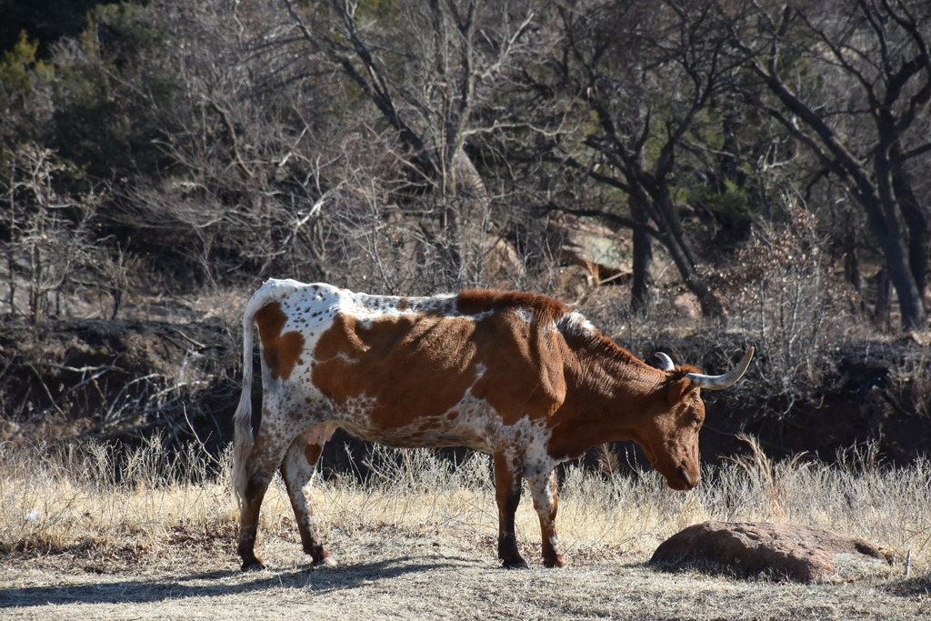

Chromatin domains organize nuclear space
Chromatin is distributed unevenly throughout the nucleus. Dense regions alternate with spaces containing less compact material. Popken and colleagues resolved this organization in bovine embryonic nuclei. Their imaging distinguished chromatin clusters from the regions between them. Nuclear organization therefore involved both the DNA-containing material and its spatial arrangement.
A fluorescent DNA stain reports where stained chromatin is concentrated. Optical sections through the same nucleus expose different cross-sections of that distribution. A compact region can appear different depending on the section examined. Three-dimensional views connect those sections into a larger structure. The combination supports a spatial description of embryonic nuclear remodeling.
Gene regulation occurs within this organized nuclear environment. Reprogramming a fibroblast nucleus requires changes in its developmental state. Those changes accompany alterations in the spatial organization of chromatin. The bovine study measured structural differences across embryo types and stages. It treated nuclear architecture as a biological outcome of reconstruction and development.
Popken et al. (2014), Fig. 1(A1, B1). Optical sections of IVF embryo nuclei at two cleavage stages, the study’s reference preparation.
Photo: Bos taurus. no rights reserved. CC0 1.0.
Popken (2014), Supplemental Movie 3. Original three-dimensional nuclear imaging.
Popken et al. (2014)
13
Notes:
• Chromatin is distributed unevenly throughout the nucleus. Dense regions alternate with spaces containing less compact material. Popken and colleagues resolved this organization in bovine embryonic nuclei. Their imaging distinguished chromatin clusters from the regions between them. Nuclear organization therefore involved both the DNA-containing material and its spatial arrangement.
• A fluorescent DNA stain reports where stained chromatin is concentrated. Optical sections through the same nucleus expose different cross-sections of that distribution. A compact region can appear different depending on the section examined. Three-dimensional views connect those sections into a larger structure. The combination supports a spatial description of embryonic nuclear remodeling.
• Gene regulation occurs within this organized nuclear environment. Reprogramming a fibroblast nucleus requires changes in its developmental state. Those changes accompany alterations in the spatial organization of chromatin. The bovine study measured structural differences across embryo types and stages. It treated nuclear architecture as a biological outcome of reconstruction and development.
References:
Popken J, Brero A, Koehler D, Schmid VJ, Strauss A, Wuensch A, Guengoer T, Graf A, Krebs S, Blum H, Zakhartchenko V, Wolf E, Cremer T (2014). Reprogramming of fibroblast nuclei in cloned bovine embryos involves major structural remodeling with both striking similarities and differences to nuclear phenotypes of in vitro fertilized embryos. Nucleus (Austin, Tex.) 5(6):555-589. https://doi.org/10.4161/19491034.2014.979712
Figure: Popken et al. (2014), Fig. 1(A1, B1). Optical sections of IVF embryo nuclei at two cleavage stages, the study’s reference preparation.
Figure source: https://doi.org/10.4161/19491034.2014.979712
Image: Photo: Bos taurus. Credit: no rights reserved. License: CC0 1.0. Source: https://www.inaturalist.org/observations/194750457
Embedded video: Popken (2014), Supplemental Movie 3. Original three-dimensional nuclear imaging.
Article: Popken J, Brero A, Koehler D, Schmid VJ, Strauss A, Wuensch A, Guengoer T, Graf A, Krebs S, Blum H, Zakhartchenko V, Wolf E, Cremer T. (2014). Reprogramming of fibroblast nuclei in cloned bovine embryos involves major structural remodeling with both striking similarities and differences to nuclear phenotypes of in vitro fertilized embryos. Nucleus (Austin, Tex.) 5:555-589. https://doi.org/10.4161/19491034.2014.979712
Exact source filename: kncl-05-06-979712-s005.avi
Original media/source page: https://www.ebi.ac.uk/europepmc/webservices/rest/PMC4615760/supplementaryFiles
Original source hash: 8d86b228495af1b06bbe3ab7f1c7246666946544cadd4d3f832a9a209cd8b671
Embedded clip hash: ff66f497dca3bd3c9cd0b4d5752b5d8262b5fcf31ac97fb5ffb76e4f9d8b20c2
Source recording interval: 0.000–85.000 s. Original scientific frames, proportions, author-provided timing and available audio retained. Playback seconds are not necessarily biological elapsed time in source time-lapse/accelerated films.
License: This is an Open Access article distributed under the terms of the Creative Commons Attribution-Non-Commercial License ( http://creativecommons.org/licenses/by-nc/3.0/ ), which permits unrestricted non-commercial use, distribution, and reproduction in any medium, provided the original work is properly cited. The moral rights of the named author(s) have been asserted.
Native PPTX movie object with a separate static poster fallback. Desktop PowerPoint GUI playback and Google Slides import have not been tested. Google Slides may require inserting the supplied MP4 from Drive after import.

Slide 14
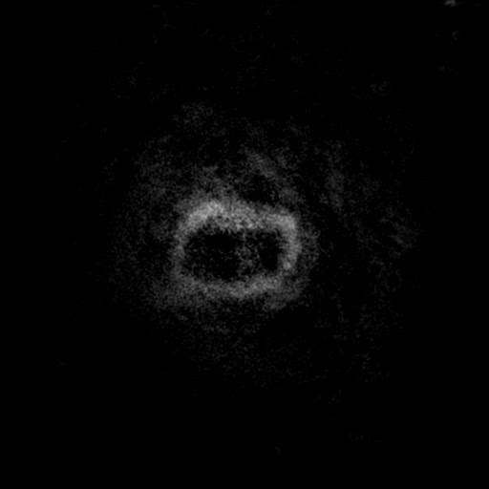
Nucleolar structures change during cleavage
The nucleolus is a nuclear structure associated with production of ribosomal components. Ribosomes are the cellular machinery that builds proteins. Early embryonic nuclei contain distinctive nucleolar precursor structures. Popken and colleagues examined these structures during bovine development. Their appearance changed as the embryos progressed through cleavage stages.
A precursor structure and a mature nucleolus represent different nuclear states. Their organization is related to the changing demands of embryonic gene activity. Microscopy can distinguish these structures from the surrounding chromatin. The study compared their appearance in cloned and fertilized embryos. Nuclear maturation could therefore be assessed through more than the presence of chromosomes alone.
Embryonic cells must produce proteins while repeatedly reorganizing their nuclei. Their nuclear structures develop alongside this changing cellular program. A reconstructed nucleus enters that program from a differentiated starting state. Observing nucleolar organization provides another measure of its developmental progression. Structural remodeling and functional maturation are connected aspects of the embryonic nucleus.
Popken et al. (2014), Fig. 1(A1, B1). Optical sections of IVF embryo nuclei at two cleavage stages, the study’s reference preparation.
Popken (2014), Supplemental Movie 4. Original three-dimensional nuclear imaging.
Popken et al. (2014)
14
Notes:
• The **nucleolus** is a nuclear structure associated with production of ribosomal components. Ribosomes are the cellular machinery that builds proteins. Early embryonic nuclei contain distinctive nucleolar precursor structures. Popken and colleagues examined these structures during bovine development. Their appearance changed as the embryos progressed through cleavage stages.
• A precursor structure and a mature nucleolus represent different nuclear states. Their organization is related to the changing demands of embryonic gene activity. Microscopy can distinguish these structures from the surrounding chromatin. The study compared their appearance in cloned and fertilized embryos. Nuclear maturation could therefore be assessed through more than the presence of chromosomes alone.
• Embryonic cells must produce proteins while repeatedly reorganizing their nuclei. Their nuclear structures develop alongside this changing cellular program. A reconstructed nucleus enters that program from a differentiated starting state. Observing nucleolar organization provides another measure of its developmental progression. Structural remodeling and functional maturation are connected aspects of the embryonic nucleus.
References:
Popken J, Brero A, Koehler D, Schmid VJ, Strauss A, Wuensch A, Guengoer T, Graf A, Krebs S, Blum H, Zakhartchenko V, Wolf E, Cremer T (2014). Reprogramming of fibroblast nuclei in cloned bovine embryos involves major structural remodeling with both striking similarities and differences to nuclear phenotypes of in vitro fertilized embryos. Nucleus (Austin, Tex.) 5(6):555-589. https://doi.org/10.4161/19491034.2014.979712
Figure: Popken et al. (2014), Fig. 1(A1, B1). Optical sections of IVF embryo nuclei at two cleavage stages, the study’s reference preparation.
Figure source: https://doi.org/10.4161/19491034.2014.979712
Embedded video: Popken (2014), Supplemental Movie 4. Original three-dimensional nuclear imaging.
Article: Popken J, Brero A, Koehler D, Schmid VJ, Strauss A, Wuensch A, Guengoer T, Graf A, Krebs S, Blum H, Zakhartchenko V, Wolf E, Cremer T. (2014). Reprogramming of fibroblast nuclei in cloned bovine embryos involves major structural remodeling with both striking similarities and differences to nuclear phenotypes of in vitro fertilized embryos. Nucleus (Austin, Tex.) 5:555-589. https://doi.org/10.4161/19491034.2014.979712
Exact source filename: kncl-05-06-979712-s004.avi
Original media/source page: https://www.ebi.ac.uk/europepmc/webservices/rest/PMC4615760/supplementaryFiles
Original source hash: fd09bb63410f81793dfb8e9db9d9b1e3e80709cb0cb1b458264dde5ae1d060f9
Embedded clip hash: 7a10602de8bb56ea3b76d1e0319d2c53da95ab12ee6b96d1857dc42f7da9bf48
Source recording interval: 0.000–80.000 s. Original scientific frames, proportions, author-provided timing and available audio retained. Playback seconds are not necessarily biological elapsed time in source time-lapse/accelerated films.
License: This is an Open Access article distributed under the terms of the Creative Commons Attribution-Non-Commercial License ( http://creativecommons.org/licenses/by-nc/3.0/ ), which permits unrestricted non-commercial use, distribution, and reproduction in any medium, provided the original work is properly cited. The moral rights of the named author(s) have been asserted.
Native PPTX movie object with a separate static poster fallback. Desktop PowerPoint GUI playback and Google Slides import have not been tested. Google Slides may require inserting the supplied MP4 from Drive after import.

Slide 15
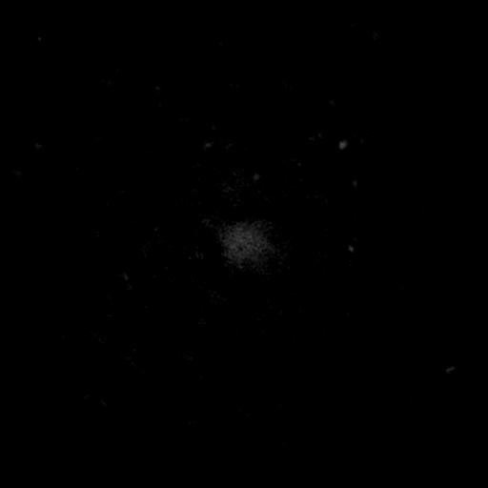
Molecular labels identify nuclear components
A DNA stain and an antibody label report different components of a nucleus. Popken and colleagues used molecular labeling alongside high-resolution microscopy. Antibodies bind particular molecular targets. Their fluorescent labels identify the distribution of the recognized material. Combining labels relates chromatin organization to proteins involved in nuclear activity.
RNA polymerase II is an enzyme involved in transcribing many genes into RNA. Modified forms of this enzyme can be examined within the nucleus. Histone modifications provide another set of molecular landmarks. Histones are proteins around which DNA is packaged. Their labeling connects chromatin structure with molecular features associated with gene regulation.
Spatial overlap between labels describes the organization of the stained components. Different labels need not occupy identical nuclear regions. The bovine experiments measured these relationships within individual nuclei. They compared organization across developmental stages and embryo types. Nuclear reprogramming consequently involved both large-scale architecture and the arrangement of specific molecular components.
Popken et al. (2014), Fig. 1(A1, B1). Optical sections of IVF embryo nuclei at two cleavage stages, the study’s reference preparation.
Popken (2014), Supplemental Movie 5. Original three-dimensional nuclear imaging.
Popken et al. (2014)
15
Notes:
• A DNA stain and an antibody label report different components of a nucleus. Popken and colleagues used molecular labeling alongside high-resolution microscopy. **Antibodies** bind particular molecular targets. Their fluorescent labels identify the distribution of the recognized material. Combining labels relates chromatin organization to proteins involved in nuclear activity.
• **RNA polymerase II** is an enzyme involved in transcribing many genes into RNA. Modified forms of this enzyme can be examined within the nucleus. Histone modifications provide another set of molecular landmarks. Histones are proteins around which DNA is packaged. Their labeling connects chromatin structure with molecular features associated with gene regulation.
• Spatial overlap between labels describes the organization of the stained components. Different labels need not occupy identical nuclear regions. The bovine experiments measured these relationships within individual nuclei. They compared organization across developmental stages and embryo types. Nuclear reprogramming consequently involved both large-scale architecture and the arrangement of specific molecular components.
References:
Popken J, Brero A, Koehler D, Schmid VJ, Strauss A, Wuensch A, Guengoer T, Graf A, Krebs S, Blum H, Zakhartchenko V, Wolf E, Cremer T (2014). Reprogramming of fibroblast nuclei in cloned bovine embryos involves major structural remodeling with both striking similarities and differences to nuclear phenotypes of in vitro fertilized embryos. Nucleus (Austin, Tex.) 5(6):555-589. https://doi.org/10.4161/19491034.2014.979712
Figure: Popken et al. (2014), Fig. 1(A1, B1). Optical sections of IVF embryo nuclei at two cleavage stages, the study’s reference preparation.
Figure source: https://doi.org/10.4161/19491034.2014.979712
Embedded video: Popken (2014), Supplemental Movie 5. Original three-dimensional nuclear imaging.
Article: Popken J, Brero A, Koehler D, Schmid VJ, Strauss A, Wuensch A, Guengoer T, Graf A, Krebs S, Blum H, Zakhartchenko V, Wolf E, Cremer T. (2014). Reprogramming of fibroblast nuclei in cloned bovine embryos involves major structural remodeling with both striking similarities and differences to nuclear phenotypes of in vitro fertilized embryos. Nucleus (Austin, Tex.) 5:555-589. https://doi.org/10.4161/19491034.2014.979712
Exact source filename: kncl-05-06-979712-s003.avi
Original media/source page: https://www.ebi.ac.uk/europepmc/webservices/rest/PMC4615760/supplementaryFiles
Original source hash: 0acfb421183f0a74aff3046479b07a45a5ae1b91d8ec3344739834a6d940bf2a
Embedded clip hash: 4f2a67a7db7e047006c0ab313376d066d54187629c9080af82b6dd423437c8c7
Source recording interval: 0.000–124.000 s. Original scientific frames, proportions, author-provided timing and available audio retained. Playback seconds are not necessarily biological elapsed time in source time-lapse/accelerated films.
License: This is an Open Access article distributed under the terms of the Creative Commons Attribution-Non-Commercial License ( http://creativecommons.org/licenses/by-nc/3.0/ ), which permits unrestricted non-commercial use, distribution, and reproduction in any medium, provided the original work is properly cited. The moral rights of the named author(s) have been asserted.
Native PPTX movie object with a separate static poster fallback. Desktop PowerPoint GUI playback and Google Slides import have not been tested. Google Slides may require inserting the supplied MP4 from Drive after import.

Slide 16

Cleavage stage changes nuclear structure
A two-cell embryo and a later cleavage-stage embryo have different developmental histories. Each has completed a different number of divisions. Their nuclei are also entering different patterns of embryonic activity. Popken and colleagues followed nuclear phenotypes through this progression. A structural feature could consequently be related to developmental stage rather than judged in isolation.
The cells produced by cleavage are called blastomeres. Each blastomere must organize its genome within a new nucleus after division. The embryo’s nuclear population therefore changes repeatedly during development. Cloned and fertilized embryos can reach similar cell counts through different starting conditions. Comparing their nuclei tests how those histories affect the structures that form.
A stage-specific nuclear phenotype is a measured developmental outcome. It can be common in one stage and less common in another. Following several stages distinguishes persistence from transition. This temporal comparison adds information beyond a single embryo photograph. Nuclear remodeling becomes a sequence of changing cellular states during early development.
Popken et al. (2014), Fig. 1(A1, B1). Optical sections of IVF embryo nuclei at two cleavage stages, the study’s reference preparation.
Popken (2014), Supplemental Movie 6. Original three-dimensional nuclear imaging.
Popken et al. (2014)
16
Notes:
• A two-cell embryo and a later cleavage-stage embryo have different developmental histories. Each has completed a different number of divisions. Their nuclei are also entering different patterns of embryonic activity. Popken and colleagues followed nuclear phenotypes through this progression. A structural feature could consequently be related to developmental stage rather than judged in isolation.
• The cells produced by cleavage are called **blastomeres**. Each blastomere must organize its genome within a new nucleus after division. The embryo’s nuclear population therefore changes repeatedly during development. Cloned and fertilized embryos can reach similar cell counts through different starting conditions. Comparing their nuclei tests how those histories affect the structures that form.
• A stage-specific nuclear phenotype is a measured developmental outcome. It can be common in one stage and less common in another. Following several stages distinguishes persistence from transition. This temporal comparison adds information beyond a single embryo photograph. Nuclear remodeling becomes a sequence of changing cellular states during early development.
References:
Popken J, Brero A, Koehler D, Schmid VJ, Strauss A, Wuensch A, Guengoer T, Graf A, Krebs S, Blum H, Zakhartchenko V, Wolf E, Cremer T (2014). Reprogramming of fibroblast nuclei in cloned bovine embryos involves major structural remodeling with both striking similarities and differences to nuclear phenotypes of in vitro fertilized embryos. Nucleus (Austin, Tex.) 5(6):555-589. https://doi.org/10.4161/19491034.2014.979712
Figure: Popken et al. (2014), Fig. 1(A1, B1). Optical sections of IVF embryo nuclei at two cleavage stages, the study’s reference preparation.
Figure source: https://doi.org/10.4161/19491034.2014.979712
Embedded video: Popken (2014), Supplemental Movie 6. Original three-dimensional nuclear imaging.
Article: Popken J, Brero A, Koehler D, Schmid VJ, Strauss A, Wuensch A, Guengoer T, Graf A, Krebs S, Blum H, Zakhartchenko V, Wolf E, Cremer T. (2014). Reprogramming of fibroblast nuclei in cloned bovine embryos involves major structural remodeling with both striking similarities and differences to nuclear phenotypes of in vitro fertilized embryos. Nucleus (Austin, Tex.) 5:555-589. https://doi.org/10.4161/19491034.2014.979712
Exact source filename: kncl-05-06-979712-s002.avi
Original media/source page: https://www.ebi.ac.uk/europepmc/webservices/rest/PMC4615760/supplementaryFiles
Original source hash: a5d1ad49b7de42f3c21484d4b738ff5cd201bbd4d1f490caf56948a2d11646dc
Embedded clip hash: 67ae14ce0b236181b3b5daae41084dedcee1e68c316e4fb988ce55cd708724c7
Source recording interval: 0.000–56.000 s. Original scientific frames, proportions, author-provided timing and available audio retained. Playback seconds are not necessarily biological elapsed time in source time-lapse/accelerated films.
License: This is an Open Access article distributed under the terms of the Creative Commons Attribution-Non-Commercial License ( http://creativecommons.org/licenses/by-nc/3.0/ ), which permits unrestricted non-commercial use, distribution, and reproduction in any medium, provided the original work is properly cited. The moral rights of the named author(s) have been asserted.
Native PPTX movie object with a separate static poster fallback. Desktop PowerPoint GUI playback and Google Slides import have not been tested. Google Slides may require inserting the supplied MP4 from Drive after import.

Slide 17
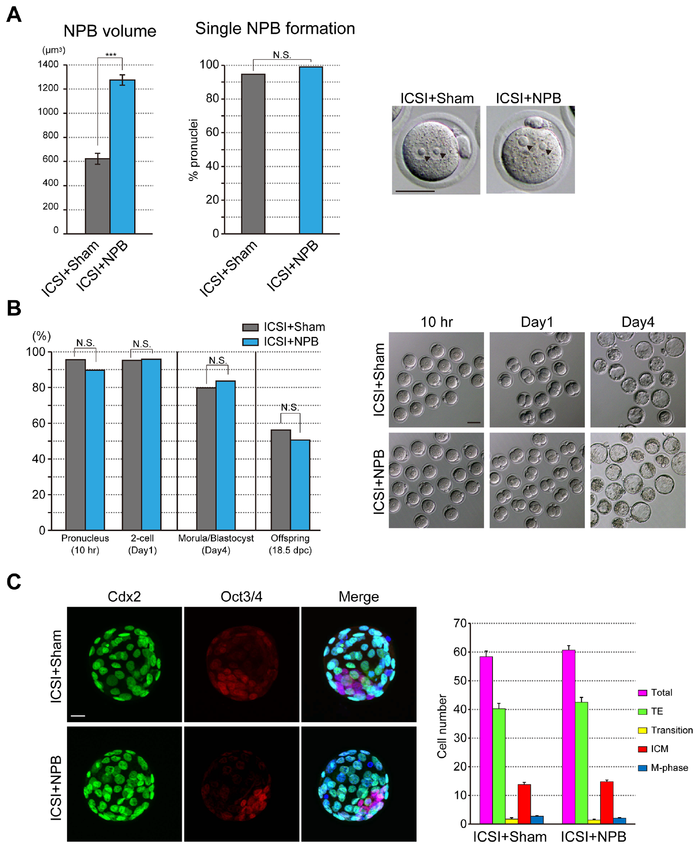
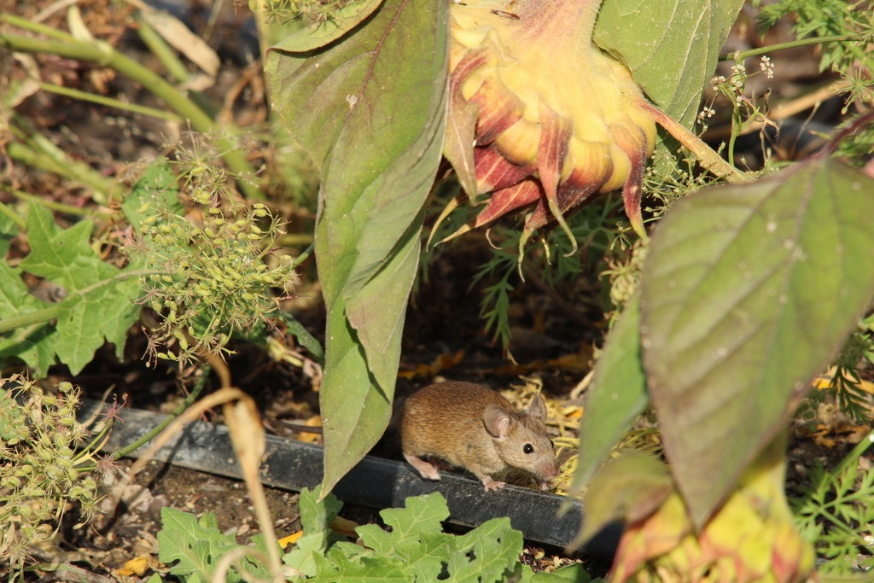
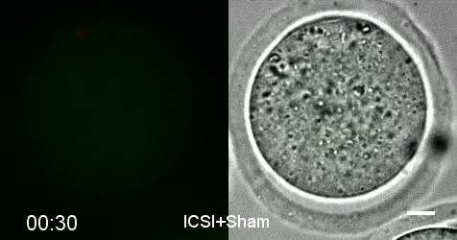
Precursor bodies fuse within a pronucleus
A pronucleus is a nucleus present before the parental genomes combine during early development. Mouse pronuclei initially contain several nucleolus precursor bodies. These are specialized, transcriptionally inactive nuclear structures. Their organization differs from that of a somatic nucleolus. Live imaging followed their movement and fusion during pronuclear formation.
Fusion combines smaller precursor bodies into a larger structure. The study labeled nucleolar material and chromatin with fluorescent proteins. These labels distinguished the precursor bodies from surrounding chromosomes. The original recordings preserve the sequence of fusion events. Nuclear organization could therefore be followed as a dynamic process rather than inferred from a fixed specimen.
The total amount of precursor-body material influenced the outcome. A limiting-component mechanism means that available material constrains the structures that form. The amount of material was related to the nuclear environment containing it. Pronuclear organization therefore depended on both nuclear space and cellular supply. The experiment connected nuclear morphology with the availability of a specific component.
Kyogoku et al. (2018), Fig. 1. Nucleolus precursor-body material and pronuclear organization.
Photo: Mus musculus. Britt Wren. CC BY 4.0.
Kyogoku (2018), S1 Movie. ICSI pronuclear precursor-body fusion.
Kyogoku et al. (2018)
17
Notes:
• A **pronucleus** is a nucleus present before the parental genomes combine during early development. Mouse pronuclei initially contain several nucleolus precursor bodies. These are specialized, transcriptionally inactive nuclear structures. Their organization differs from that of a somatic nucleolus. Live imaging followed their movement and fusion during pronuclear formation.
• Fusion combines smaller precursor bodies into a larger structure. The study labeled nucleolar material and chromatin with fluorescent proteins. These labels distinguished the precursor bodies from surrounding chromosomes. The original recordings preserve the sequence of fusion events. Nuclear organization could therefore be followed as a dynamic process rather than inferred from a fixed specimen.
• The total amount of precursor-body material influenced the outcome. A limiting-component mechanism means that available material constrains the structures that form. The amount of material was related to the nuclear environment containing it. Pronuclear organization therefore depended on both nuclear space and cellular supply. The experiment connected nuclear morphology with the availability of a specific component.
References:
Kyogoku H, Wakayama T, Kitajima TS, Miyano T (2018). Single nucleolus precursor body formation in the pronucleus of mouse zygotes and SCNT embryos. PloS one 13(8):e0202663. https://doi.org/10.1371/journal.pone.0202663
Figure: Kyogoku et al. (2018), Fig. 1. Nucleolus precursor-body material and pronuclear organization.
Figure source: https://doi.org/10.1371/journal.pone.0202663
Image: Photo: Mus musculus. Credit: (c) Britt Wren, some rights reserved (CC BY). License: CC BY 4.0. Source: https://www.inaturalist.org/observations/409965733
Embedded video: Kyogoku (2018), S1 Movie. ICSI pronuclear precursor-body fusion.
Article: Kyogoku H, Wakayama T, Kitajima TS, Miyano T. (2018). Single nucleolus precursor body formation in the pronucleus of mouse zygotes and SCNT embryos. PloS one 13:e0202663. https://doi.org/10.1371/journal.pone.0202663
Exact source filename: pone.0202663.s002.avi
Original media/source page: https://www.ebi.ac.uk/europepmc/webservices/rest/PMC6101414/supplementaryFiles
Original source hash: 0caad2148b22c42f18b0e5a77ae761be8e519c48c958f0af639eb28920570e5c
Embedded clip hash: 35cf8ccee2ad205b16f4b6b60eeee87a2c01a4c7e7e1fef5a8983247127661ea
Source recording interval: 0.000–7.133 s. Original scientific frames, proportions, author-provided timing and available audio retained. Playback seconds are not necessarily biological elapsed time in source time-lapse/accelerated films.
License: https://creativecommons.org/licenses/by/4.0/ This is an open access article distributed under the terms of the Creative Commons Attribution License , which permits unrestricted use, distribution, and reproduction in any medium, provided the original author and source are credited.
Native PPTX movie object with a separate static poster fallback. Desktop PowerPoint GUI playback and Google Slides import have not been tested. Google Slides may require inserting the supplied MP4 from Drive after import.

Slide 18
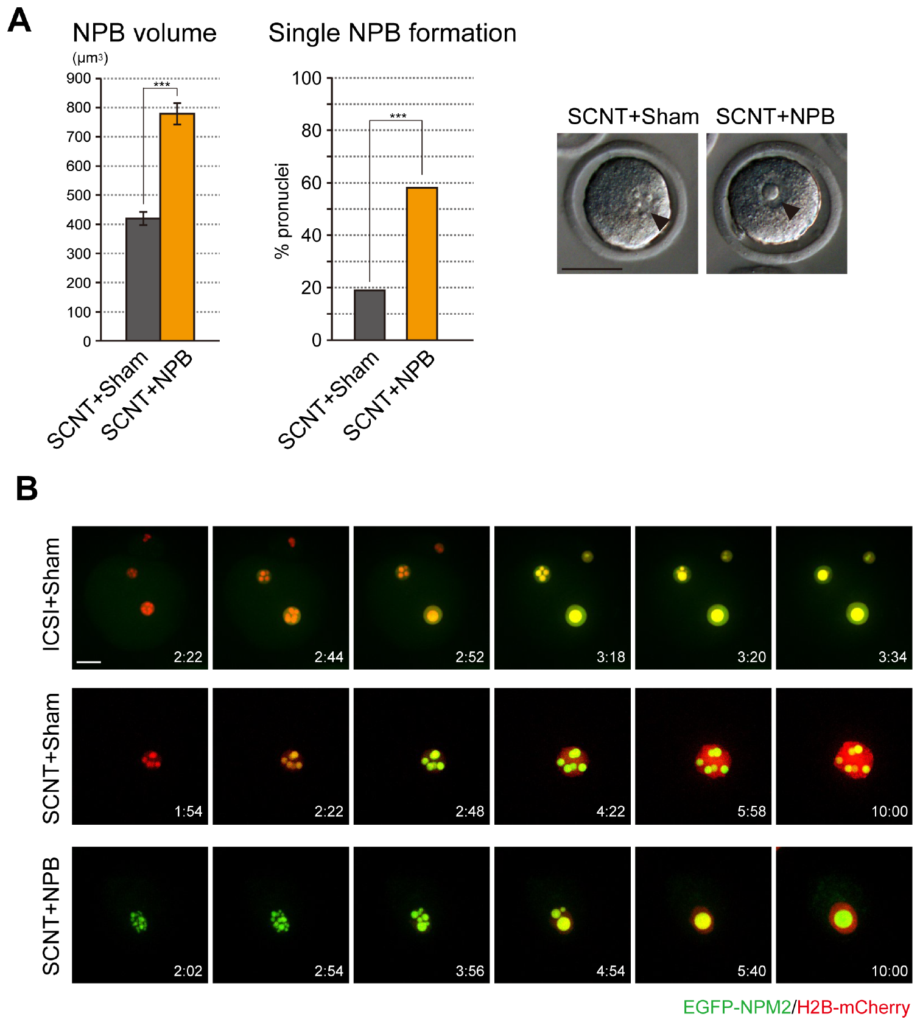
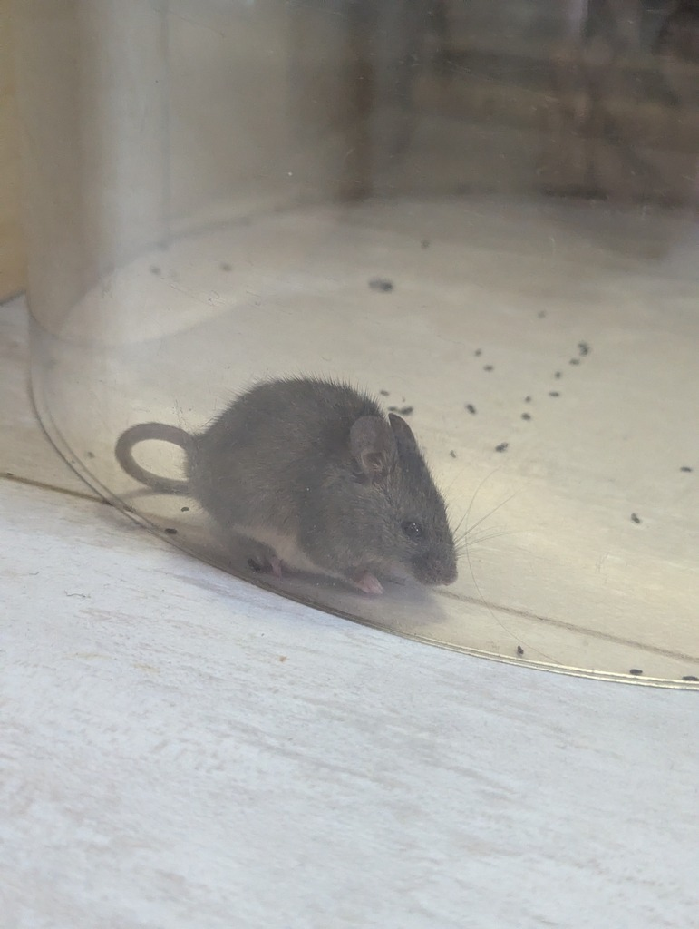
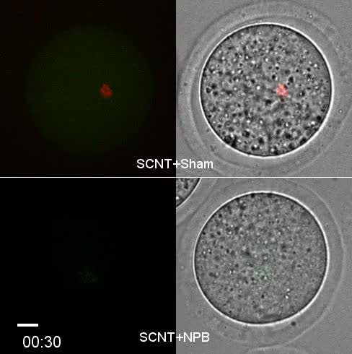
Extra precursor material changes SCNT nuclei
SCNT mouse embryos often maintained multiple nucleolus precursor bodies. Fertilized embryos more often consolidated these structures into a single large body. The study tested whether material supply contributed to this difference. Investigators added extra precursor material to recipient oocytes before reconstruction. They then followed organization inside the reconstructed nucleus.
An SCNT nucleus at this stage is described as a pseudo-pronucleus. The term distinguishes its somatic origin from the parental pronuclei of a fertilized egg. Extra precursor material reduced the number of separate bodies maintained within it. The intervention changed a recognizable nuclear phenotype. It therefore linked the original difference to the amount of available material.
The experiment manipulated a cellular component rather than replacing the donor genome. Nuclear identity alone therefore did not determine this structural outcome. The recipient oocyte also supplied material needed for reorganization. Fusion depended on the reconstructed nucleus and its surrounding cellular resources. Embryonic nuclear remodeling emerges from the interaction between these contributions.
Kyogoku et al. (2018), Fig. 3. Nucleolus precursor bodies in reconstructed mouse embryos.
Photo: Mus musculus. Ольга Таланцева. CC BY 4.0.
Kyogoku (2018), S2 Movie. Extra-NPB SCNT nuclear organization.
Kyogoku et al. (2018)
18
Notes:
• SCNT mouse embryos often maintained multiple nucleolus precursor bodies. Fertilized embryos more often consolidated these structures into a single large body. The study tested whether material supply contributed to this difference. Investigators added extra precursor material to recipient oocytes before reconstruction. They then followed organization inside the reconstructed nucleus.
• An SCNT nucleus at this stage is described as a **pseudo-pronucleus**. The term distinguishes its somatic origin from the parental pronuclei of a fertilized egg. Extra precursor material reduced the number of separate bodies maintained within it. The intervention changed a recognizable nuclear phenotype. It therefore linked the original difference to the amount of available material.
• The experiment manipulated a cellular component rather than replacing the donor genome. Nuclear identity alone therefore did not determine this structural outcome. The recipient oocyte also supplied material needed for reorganization. Fusion depended on the reconstructed nucleus and its surrounding cellular resources. Embryonic nuclear remodeling emerges from the interaction between these contributions.
References:
Kyogoku H, Wakayama T, Kitajima TS, Miyano T (2018). Single nucleolus precursor body formation in the pronucleus of mouse zygotes and SCNT embryos. PloS one 13(8):e0202663. https://doi.org/10.1371/journal.pone.0202663
Figure: Kyogoku et al. (2018), Fig. 3. Nucleolus precursor bodies in reconstructed mouse embryos.
Figure source: https://doi.org/10.1371/journal.pone.0202663
Image: Photo: Mus musculus. Credit: (c) Ольга Таланцева, some rights reserved (CC BY). License: CC BY 4.0. Source: https://www.inaturalist.org/observations/409865669
Embedded video: Kyogoku (2018), S2 Movie. Extra-NPB SCNT nuclear organization.
Article: Kyogoku H, Wakayama T, Kitajima TS, Miyano T. (2018). Single nucleolus precursor body formation in the pronucleus of mouse zygotes and SCNT embryos. PloS one 13:e0202663. https://doi.org/10.1371/journal.pone.0202663
Exact source filename: pone.0202663.s003.avi
Original media/source page: https://www.ebi.ac.uk/europepmc/webservices/rest/PMC6101414/supplementaryFiles
Original source hash: 74206925e63184430bb7488787dd780cfc689143ef17581234fc374891eced35
Embedded clip hash: 4035e038693f6d1d19cf4aa7726ddbeffa6099f9238a244f7ec750447c0262ad
Source recording interval: 0.000–20.000 s. Original scientific frames, proportions, author-provided timing and available audio retained. Playback seconds are not necessarily biological elapsed time in source time-lapse/accelerated films.
License: https://creativecommons.org/licenses/by/4.0/ This is an open access article distributed under the terms of the Creative Commons Attribution License , which permits unrestricted use, distribution, and reproduction in any medium, provided the original author and source are credited.
Native PPTX movie object with a separate static poster fallback. Desktop PowerPoint GUI playback and Google Slides import have not been tested. Google Slides may require inserting the supplied MP4 from Drive after import.

Slide 19
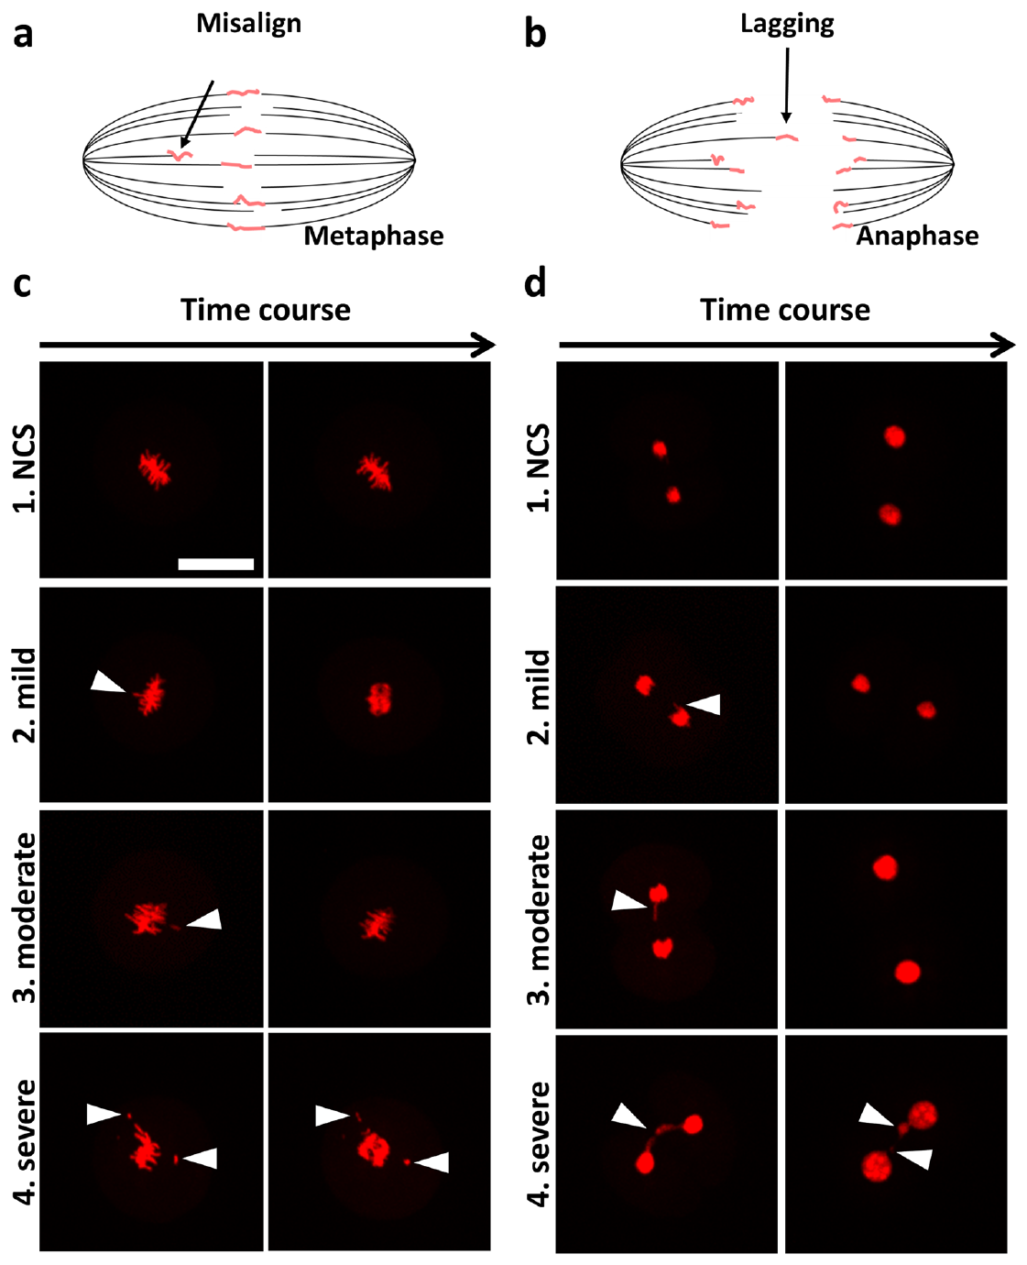
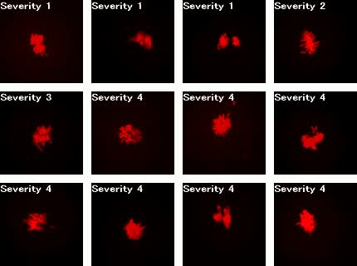
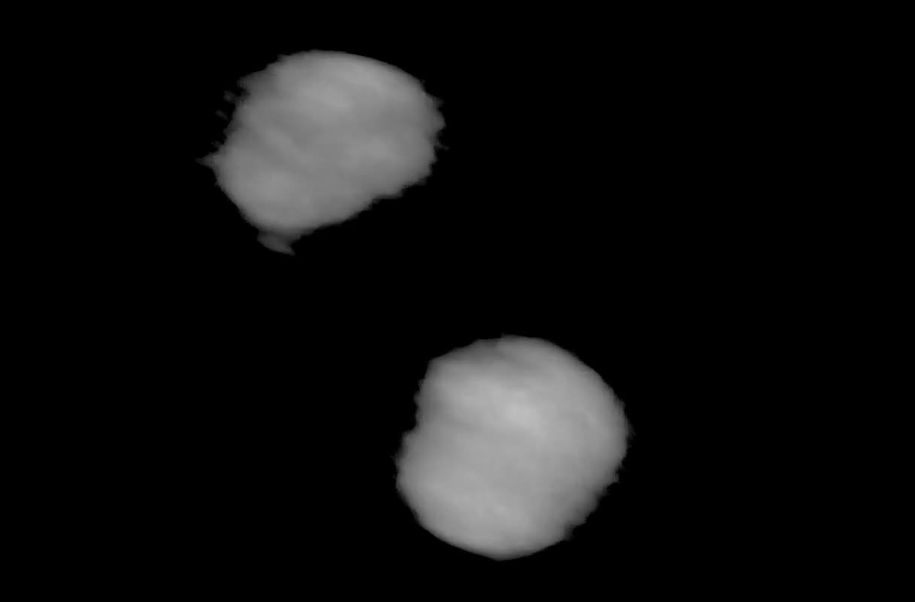
Early chromosome segregation is observable
Chromosome segregation distributes chromosomes between daughter cells during division. Errors can place a chromosome or chromosome fragment outside the main nucleus. Such material can form a micronucleus. A mouse embryo study used live imaging to follow these events. These were fertilized embryos, providing a developmental comparison rather than an SCNT preparation.
Fluorescent chromosome labeling exposed the sequence of early mitosis. Investigators then followed embryos beyond the imaged division. This connected an observed segregation event with subsequent development. Different errors produced different nuclear arrangements. A micronucleus could consequently be interpreted in relation to the event that generated it.
A cleavage-stage image records only one point in development. Continuous imaging preserves the order of chromosome movement and nuclear formation. Following the embryo further connects cellular events with organismal outcomes. The study also examined chromosome constitution using sequencing. Developmental appearance and genetic composition were therefore assessed through complementary methods.
Mashiko et al. (2020), Fig. 2. Observed chromosome segregation errors in fertilized mouse embryos.
Mashiko (2020), 41598_2020_57817_MOESM4_ESM.avi. Fertilized mouse embryo chromosome comparison.
Mashiko (2020), 41598_2020_57817_MOESM5_ESM.mov. Fertilized mouse embryo chromosome comparison.
Mashiko et al. (2020)
19
Notes:
• **Chromosome segregation** distributes chromosomes between daughter cells during division. Errors can place a chromosome or chromosome fragment outside the main nucleus. Such material can form a **micronucleus**. A mouse embryo study used live imaging to follow these events. These were fertilized embryos, providing a developmental comparison rather than an SCNT preparation.
• Fluorescent chromosome labeling exposed the sequence of early mitosis. Investigators then followed embryos beyond the imaged division. This connected an observed segregation event with subsequent development. Different errors produced different nuclear arrangements. A micronucleus could consequently be interpreted in relation to the event that generated it.
• A cleavage-stage image records only one point in development. Continuous imaging preserves the order of chromosome movement and nuclear formation. Following the embryo further connects cellular events with organismal outcomes. The study also examined chromosome constitution using sequencing. Developmental appearance and genetic composition were therefore assessed through complementary methods.
References:
Mashiko D, Ikeda Z, Yao T, Tokoro M, Fukunaga N, Asada Y, Yamagata K (2020). Chromosome segregation error during early cleavage in mouse pre-implantation embryo does not necessarily cause developmental failure after blastocyst stage. Scientific reports 10(1):854. https://doi.org/10.1038/s41598-020-57817-x
Figure: Mashiko et al. (2020), Fig. 2. Observed chromosome segregation errors in fertilized mouse embryos.
Figure source: https://doi.org/10.1038/s41598-020-57817-x
Embedded video: Mashiko (2020), 41598_2020_57817_MOESM4_ESM.avi. Fertilized mouse embryo chromosome comparison.
Article: Mashiko D, Ikeda Z, Yao T, Tokoro M, Fukunaga N, Asada Y, Yamagata K. (2020). Chromosome segregation error during early cleavage in mouse pre-implantation embryo does not necessarily cause developmental failure after blastocyst stage. Scientific reports 10:854. https://doi.org/10.1038/s41598-020-57817-x
Exact source filename: 41598_2020_57817_MOESM4_ESM.avi
Original media/source page: https://www.ebi.ac.uk/europepmc/webservices/rest/PMC6972754/supplementaryFiles
Original source hash: 88c46dc7c3a7df066c93b94162415d6e8f3a7e3af62063847f185cbbee3af399
Embedded clip hash: 722972e4a6abbf6f6305558ef24085e46834c71fb4ca36a944537604865642ff
Source recording interval: 0.000–6.667 s. Original scientific frames, proportions, author-provided timing and available audio retained. Playback seconds are not necessarily biological elapsed time in source time-lapse/accelerated films.
License: Open Access This article is licensed under a Creative Commons Attribution 4.0 International License, which permits use, sharing, adaptation, distribution and reproduction in any medium or format, as long as you give appropriate credit to the original author(s) and the source, provide a link to the Creative Commons license, and indicate if changes were made. The images or other third party material in this article are included in the article’s Creative Commons license, unless indicated otherwise in a credit line to the material. If material is not included in the article’s Creative Commons license and your intended use is not permitted by statutory regulation or exceeds the permitted use, you will need to obtain permission directly from the copyright holder. To view a copy of this license, visit http://creativecommons.org/licenses/by/4.0/ .
Native PPTX movie object with a separate static poster fallback. Desktop PowerPoint GUI playback and Google Slides import have not been tested. Google Slides may require inserting the supplied MP4 from Drive after import.
Embedded video: Mashiko (2020), 41598_2020_57817_MOESM5_ESM.mov. Fertilized mouse embryo chromosome comparison.
Article: Mashiko D, Ikeda Z, Yao T, Tokoro M, Fukunaga N, Asada Y, Yamagata K. (2020). Chromosome segregation error during early cleavage in mouse pre-implantation embryo does not necessarily cause developmental failure after blastocyst stage. Scientific reports 10:854. https://doi.org/10.1038/s41598-020-57817-x
Exact source filename: 41598_2020_57817_MOESM5_ESM.mov
Original media/source page: https://www.ebi.ac.uk/europepmc/webservices/rest/PMC6972754/supplementaryFiles
Original source hash: 302d8e4ab901d458949dccedc865b23735f0ba8121f669902c671751395dd5f2
Embedded clip hash: be61232636e23430b52c27e17a3ab8a4e13b633da515ceff8d2f47cd682cdd90
Source recording interval: 0.000–5.050 s. Original scientific frames, proportions, author-provided timing and available audio retained. Playback seconds are not necessarily biological elapsed time in source time-lapse/accelerated films.
License: Open Access This article is licensed under a Creative Commons Attribution 4.0 International License, which permits use, sharing, adaptation, distribution and reproduction in any medium or format, as long as you give appropriate credit to the original author(s) and the source, provide a link to the Creative Commons license, and indicate if changes were made. The images or other third party material in this article are included in the article’s Creative Commons license, unless indicated otherwise in a credit line to the material. If material is not included in the article’s Creative Commons license and your intended use is not permitted by statutory regulation or exceeds the permitted use, you will need to obtain permission directly from the copyright holder. To view a copy of this license, visit http://creativecommons.org/licenses/by/4.0/ .
Native PPTX movie object with a separate static poster fallback. Desktop PowerPoint GUI playback and Google Slides import have not been tested. Google Slides may require inserting the supplied MP4 from Drive after import.

Slide 20
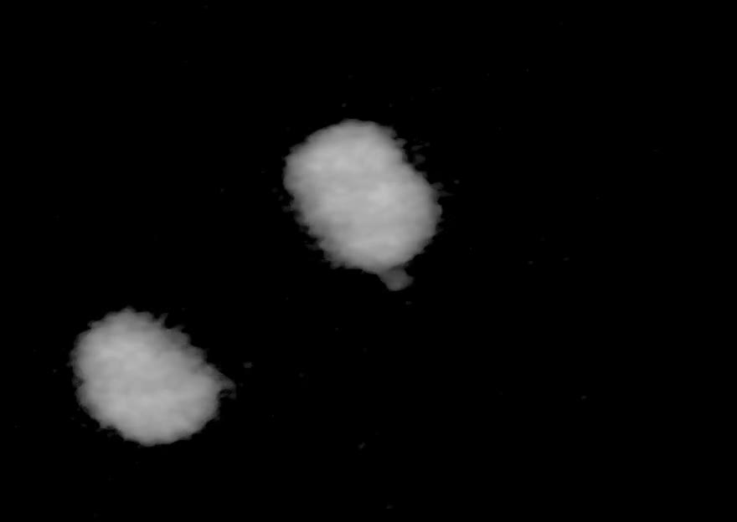
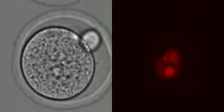
Micronuclei permit different later outcomes
Some mouse embryos containing micronuclei continued development after the blastocyst stage. The study followed embryos after directly observing early segregation errors. Its recordings included an embryo that subsequently produced an offspring. This result changes how an early morphological abnormality should be interpreted. The presence of a micronucleus was not an automatic developmental endpoint.
The blastocyst is a preimplantation stage containing a fluid-filled cavity and distinct cell populations. Reaching this stage requires several earlier divisions. Continuing beyond it imposes additional developmental demands. The study related early chromosome behavior to these later outcomes. It therefore separated a detected cellular event from the embryo’s eventual developmental trajectory.
The comparison is relevant when evaluating reconstructed embryos by appearance. A visible irregularity can have different consequences depending on its origin and extent. Genetic analysis provides information beyond morphology alone. Time-resolved observation adds the history of the irregularity. These measurements examine different aspects of the relationship between nuclear organization and development.
Mashiko et al. (2020), Fig. 2. Observed chromosome segregation errors in fertilized mouse embryos.
Mashiko (2020), 41598_2020_57817_MOESM2_ESM.mp4. Fertilized mouse embryo chromosome comparison.
Mashiko (2020), 41598_2020_57817_MOESM3_ESM.mov. Fertilized mouse embryo chromosome comparison.
Mashiko et al. (2020)
20
Notes:
• Some mouse embryos containing micronuclei continued development after the blastocyst stage. The study followed embryos after directly observing early segregation errors. Its recordings included an embryo that subsequently produced an offspring. This result changes how an early morphological abnormality should be interpreted. The presence of a micronucleus was not an automatic developmental endpoint.
• The **blastocyst** is a preimplantation stage containing a fluid-filled cavity and distinct cell populations. Reaching this stage requires several earlier divisions. Continuing beyond it imposes additional developmental demands. The study related early chromosome behavior to these later outcomes. It therefore separated a detected cellular event from the embryo’s eventual developmental trajectory.
• The comparison is relevant when evaluating reconstructed embryos by appearance. A visible irregularity can have different consequences depending on its origin and extent. Genetic analysis provides information beyond morphology alone. Time-resolved observation adds the history of the irregularity. These measurements examine different aspects of the relationship between nuclear organization and development.
References:
Mashiko D, Ikeda Z, Yao T, Tokoro M, Fukunaga N, Asada Y, Yamagata K (2020). Chromosome segregation error during early cleavage in mouse pre-implantation embryo does not necessarily cause developmental failure after blastocyst stage. Scientific reports 10(1):854. https://doi.org/10.1038/s41598-020-57817-x
Figure: Mashiko et al. (2020), Fig. 2. Observed chromosome segregation errors in fertilized mouse embryos.
Figure source: https://doi.org/10.1038/s41598-020-57817-x
Embedded video: Mashiko (2020), 41598_2020_57817_MOESM2_ESM.mp4. Fertilized mouse embryo chromosome comparison.
Article: Mashiko D, Ikeda Z, Yao T, Tokoro M, Fukunaga N, Asada Y, Yamagata K. (2020). Chromosome segregation error during early cleavage in mouse pre-implantation embryo does not necessarily cause developmental failure after blastocyst stage. Scientific reports 10:854. https://doi.org/10.1038/s41598-020-57817-x
Exact source filename: 41598_2020_57817_MOESM2_ESM.mp4
Original media/source page: https://www.ebi.ac.uk/europepmc/webservices/rest/PMC6972754/supplementaryFiles
Original source hash: eb70104a6a3992c5ec132d77c5d623242210cf7b6823e29aa79f265cbdd79772
Embedded clip hash: f9333473e30da29a389d6a401a027395a50ffc6bbc867d3dd76044db9c547a1f
Source recording interval: 0.000–25.300 s. Original scientific frames, proportions, author-provided timing and available audio retained. Playback seconds are not necessarily biological elapsed time in source time-lapse/accelerated films.
License: Open Access This article is licensed under a Creative Commons Attribution 4.0 International License, which permits use, sharing, adaptation, distribution and reproduction in any medium or format, as long as you give appropriate credit to the original author(s) and the source, provide a link to the Creative Commons license, and indicate if changes were made. The images or other third party material in this article are included in the article’s Creative Commons license, unless indicated otherwise in a credit line to the material. If material is not included in the article’s Creative Commons license and your intended use is not permitted by statutory regulation or exceeds the permitted use, you will need to obtain permission directly from the copyright holder. To view a copy of this license, visit http://creativecommons.org/licenses/by/4.0/ .
Native PPTX movie object with a separate static poster fallback. Desktop PowerPoint GUI playback and Google Slides import have not been tested. Google Slides may require inserting the supplied MP4 from Drive after import.
Embedded video: Mashiko (2020), 41598_2020_57817_MOESM3_ESM.mov. Fertilized mouse embryo chromosome comparison.
Article: Mashiko D, Ikeda Z, Yao T, Tokoro M, Fukunaga N, Asada Y, Yamagata K. (2020). Chromosome segregation error during early cleavage in mouse pre-implantation embryo does not necessarily cause developmental failure after blastocyst stage. Scientific reports 10:854. https://doi.org/10.1038/s41598-020-57817-x
Exact source filename: 41598_2020_57817_MOESM3_ESM.mov
Original media/source page: https://www.ebi.ac.uk/europepmc/webservices/rest/PMC6972754/supplementaryFiles
Original source hash: a10c0b1d77ef19d5470466875994d0d2f1e33115be296e0ee1e6d4d090ef7cf7
Embedded clip hash: a06c0ef05382033c8dcc5ead01c5e3bc6c0c649e9d01e6ba3fa1871c36b4e2bd
Source recording interval: 0.000–5.050 s. Original scientific frames, proportions, author-provided timing and available audio retained. Playback seconds are not necessarily biological elapsed time in source time-lapse/accelerated films.
License: Open Access This article is licensed under a Creative Commons Attribution 4.0 International License, which permits use, sharing, adaptation, distribution and reproduction in any medium or format, as long as you give appropriate credit to the original author(s) and the source, provide a link to the Creative Commons license, and indicate if changes were made. The images or other third party material in this article are included in the article’s Creative Commons license, unless indicated otherwise in a credit line to the material. If material is not included in the article’s Creative Commons license and your intended use is not permitted by statutory regulation or exceeds the permitted use, you will need to obtain permission directly from the copyright holder. To view a copy of this license, visit http://creativecommons.org/licenses/by/4.0/ .
Native PPTX movie object with a separate static poster fallback. Desktop PowerPoint GUI playback and Google Slides import have not been tested. Google Slides may require inserting the supplied MP4 from Drive after import.

Slide 21
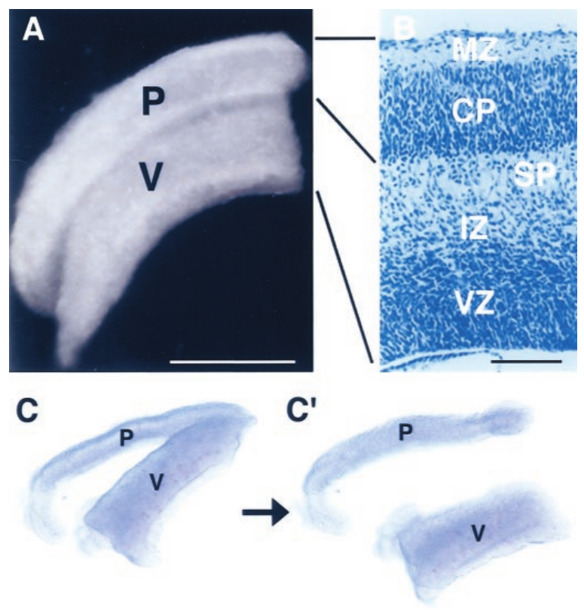
Cortical donor state affects development
The cerebral cortex develops from neural cells that change as they mature. The ventricular side of the embryonic cortex contains relatively immature neural populations. Cells toward the pial surface are further along in differentiation. Yamazaki and colleagues collected donor cells from these different regions. They transferred their nuclei into enucleated mouse oocytes.
Embryos reconstructed from the different donor populations had different developmental outcomes. Ventricular-side donors more often supported morphologically normal development. More differentiated pial-side donors produced a larger proportion of abnormal embryos. Some abnormalities affected the neural tube. The donor’s developmental state therefore influenced the outcome of nuclear reconstruction.
The neural tube is the embryonic structure from which the central nervous system develops. Its formation requires coordinated tissue organization as well as cell proliferation. The study assessed development beyond the first cleavage divisions. Its outcomes linked the state of a neural donor cell with subsequent embryogenesis. Neural specialization and nuclear developmental competence could thus be investigated experimentally.
Yamazaki et al. (2001), Fig. 2. Embryonic cerebral cortex and the locations of neural donor populations.
Yamazaki et al. (2001)
21
Notes:
• The **cerebral cortex** develops from neural cells that change as they mature. The ventricular side of the embryonic cortex contains relatively immature neural populations. Cells toward the pial surface are further along in differentiation. Yamazaki and colleagues collected donor cells from these different regions. They transferred their nuclei into enucleated mouse oocytes.
• Embryos reconstructed from the different donor populations had different developmental outcomes. Ventricular-side donors more often supported morphologically normal development. More differentiated pial-side donors produced a larger proportion of abnormal embryos. Some abnormalities affected the neural tube. The donor’s developmental state therefore influenced the outcome of nuclear reconstruction.
• The **neural tube** is the embryonic structure from which the central nervous system develops. Its formation requires coordinated tissue organization as well as cell proliferation. The study assessed development beyond the first cleavage divisions. Its outcomes linked the state of a neural donor cell with subsequent embryogenesis. Neural specialization and nuclear developmental competence could thus be investigated experimentally.
References:
Yamazaki Y, Makino H, Hamaguchi-Hamada K, Hamada S, Sugino H, Kawase E, Miyata T, Ogawa M, Yanagimachi R, Yagi T (2001). Assessment of the developmental totipotency of neural cells in the cerebral cortex of mouse embryo by nuclear transfer. Proceedings of the National Academy of Sciences of the United States of America 98(24):14022-14026. https://doi.org/10.1073/pnas.231489398
Figure: Yamazaki et al. (2001), Fig. 2. Embryonic cerebral cortex and the locations of neural donor populations.
Figure source: https://doi.org/10.1073/pnas.231489398

Slide 22
Adult neuronal nuclei retain genomic potential
A mature neuron is a highly specialized somatic cell. Its gene-expression program supports neuronal structure and signaling. Direct nuclear-transfer experiments subsequently generated cloned mice from adult neurons. The transferred nucleus therefore retained a genome capable of supporting another developmental program. Cellular specialization had not simply removed the genes needed to construct other tissues.
The earlier embryonic-cortex experiments found strong differences among donor populations. They also proposed explanations for those differences. A hypothesis of irreversible genomic change was one possible interpretation at that time. Later adult-neuron cloning supplied a different experimental test of developmental potential. Successful offspring connected a specialized neuronal nucleus with whole-animal development.
Differentiation is the acquisition of specialized cellular properties during development. It involves selective gene activity within a cell’s genome. Nuclear transfer changes the regulatory environment acting on that genome. A neuron’s current function and its nucleus’s developmental potential are therefore distinct properties. Their experimental separation connects nervous-system specialization with epigenetic reprogramming.
Yamazaki et al. (2001), Fig. 2. Embryonic cerebral cortex and the locations of neural donor populations.
Mizutani et al. (2015); Yamazaki et al. (2001)
22
Notes:
• A mature neuron is a highly specialized somatic cell. Its gene-expression program supports neuronal structure and signaling. Direct nuclear-transfer experiments subsequently generated cloned mice from adult neurons. The transferred nucleus therefore retained a genome capable of supporting another developmental program. Cellular specialization had not simply removed the genes needed to construct other tissues.
• The earlier embryonic-cortex experiments found strong differences among donor populations. They also proposed explanations for those differences. A hypothesis of irreversible genomic change was one possible interpretation at that time. Later adult-neuron cloning supplied a different experimental test of developmental potential. Successful offspring connected a specialized neuronal nucleus with whole-animal development.
• **Differentiation** is the acquisition of specialized cellular properties during development. It involves selective gene activity within a cell’s genome. Nuclear transfer changes the regulatory environment acting on that genome. A neuron’s current function and its nucleus’s developmental potential are therefore distinct properties. Their experimental separation connects nervous-system specialization with epigenetic reprogramming.
References:
Mizutani E, Oikawa M, Kassai H, Inoue K, Shiura H, Hirasawa R, Kamimura S, Matoba S, Ogonuki N, Nagatomo H, Abe K, Wakayama T, Aiba A, Ogura A (2015). Generation of cloned mice from adult neurons by direct nuclear transfer. Biology of reproduction 92(3):81. https://doi.org/10.1095/biolreprod.114.123455
Yamazaki Y, Makino H, Hamaguchi-Hamada K, Hamada S, Sugino H, Kawase E, Miyata T, Ogawa M, Yanagimachi R, Yagi T (2001). Assessment of the developmental totipotency of neural cells in the cerebral cortex of mouse embryo by nuclear transfer. Proceedings of the National Academy of Sciences of the United States of America 98(24):14022-14026. https://doi.org/10.1073/pnas.231489398
Figure: Yamazaki et al. (2001), Fig. 2. Embryonic cerebral cortex and the locations of neural donor populations.
Figure source: https://doi.org/10.1073/pnas.231489398

Slide 23
New embryos build their own nervous systems
A cloned mouse must develop an organized nervous system as part of whole-animal development. That system arises during the embryo’s own development. It is not a nervous system carried over from the donor animal. The cortical nuclear-transfer experiments assessed both embryonic morphology and live offspring. Their observations connected nuclear reconstruction with later tissue formation.
Neural-tube abnormalities occurred among reconstructed embryos in the cortical-donor study. The frequency of abnormal development depended on the donor population. This related a donor-cell property to the reconstructed embryo’s organization. The embryo still had to build its tissues through development. A transferred nucleus supplied genetic material rather than a preassembled neural circuit.
A live offspring represents a coordinated outcome across many developing tissues. Neural structures must develop alongside muscles and sensory organs. Those structures then support the animal’s own activity after birth. Nuclear cloning therefore reproduces a nuclear genetic contribution through a new developmental process. It does not transfer the donor animal’s learned experiences as an existing circuit.
Yamazaki et al. (2001), Fig. 2. Embryonic cerebral cortex and the locations of neural donor populations.
Yamazaki et al. (2001)
23
Notes:
• A cloned mouse must develop an organized nervous system as part of whole-animal development. That system arises during the embryo’s own development. It is not a nervous system carried over from the donor animal. The cortical nuclear-transfer experiments assessed both embryonic morphology and live offspring. Their observations connected nuclear reconstruction with later tissue formation.
• Neural-tube abnormalities occurred among reconstructed embryos in the cortical-donor study. The frequency of abnormal development depended on the donor population. This related a donor-cell property to the reconstructed embryo’s organization. The embryo still had to build its tissues through development. A transferred nucleus supplied genetic material rather than a preassembled neural circuit.
• A live offspring represents a coordinated outcome across many developing tissues. Neural structures must develop alongside muscles and sensory organs. Those structures then support the animal’s own activity after birth. Nuclear cloning therefore reproduces a nuclear genetic contribution through a new developmental process. It does not transfer the donor animal’s learned experiences as an existing circuit.
References:
Yamazaki Y, Makino H, Hamaguchi-Hamada K, Hamada S, Sugino H, Kawase E, Miyata T, Ogawa M, Yanagimachi R, Yagi T (2001). Assessment of the developmental totipotency of neural cells in the cerebral cortex of mouse embryo by nuclear transfer. Proceedings of the National Academy of Sciences of the United States of America 98(24):14022-14026. https://doi.org/10.1073/pnas.231489398
Figure: Yamazaki et al. (2001), Fig. 2. Embryonic cerebral cortex and the locations of neural donor populations.
Figure source: https://doi.org/10.1073/pnas.231489398

Slide 24
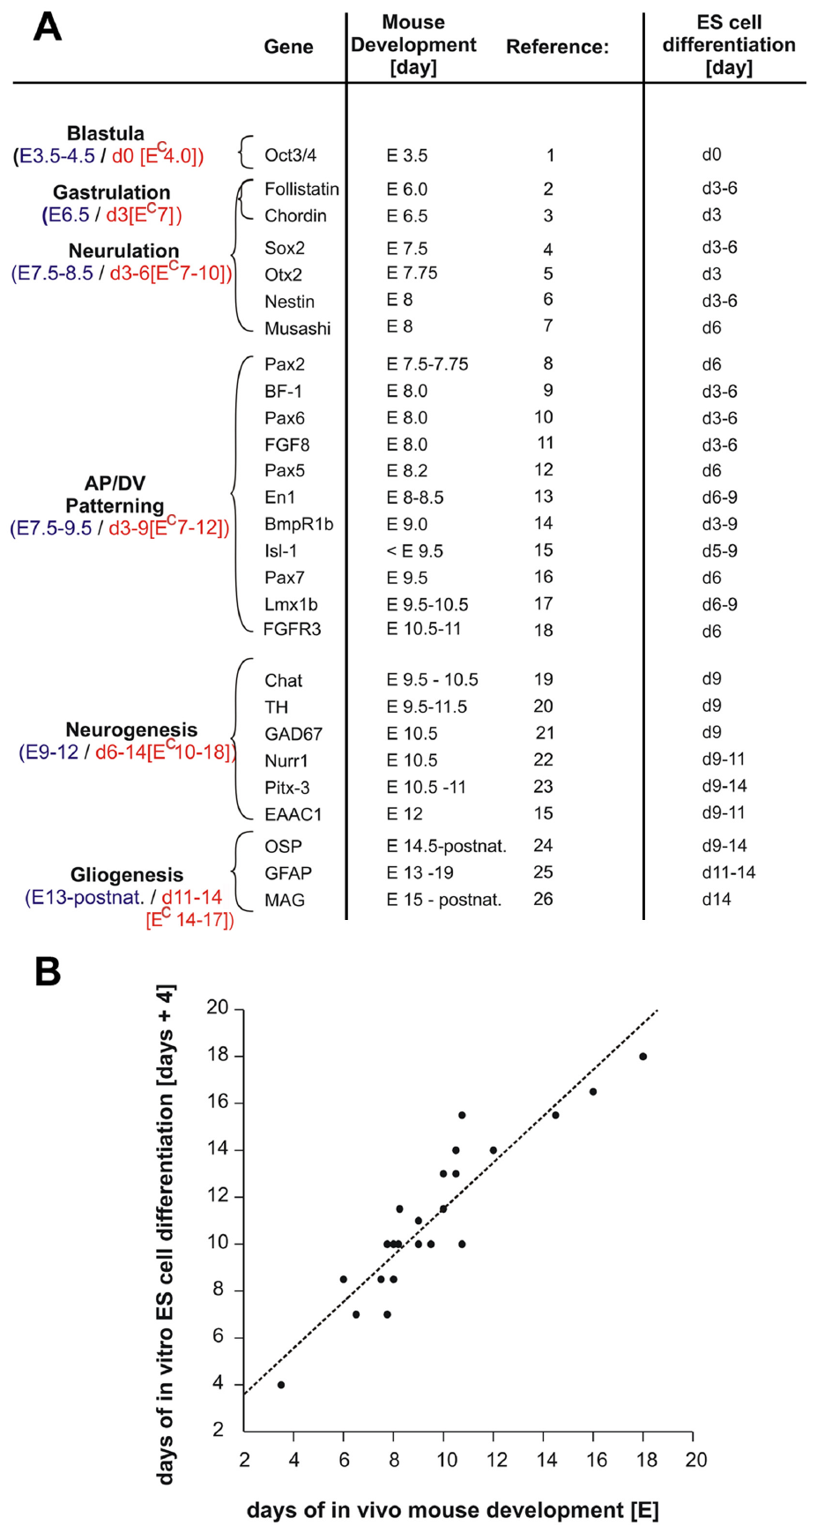
Neural differentiation follows gene activation
Pluripotent stem cells can generate multiple specialized cell types. Barberi and colleagues compared neural differentiation from fertilization-derived and nuclear-transfer-derived embryonic stem cells. The preparation involved cultured cells rather than cloned adult recipients. Cells activated different genes as differentiation progressed. Their developmental state could therefore be followed through successive molecular markers.
A marker is a measured feature used to identify a cellular state. The study compared expression timing during culture with timing in mouse development. Early neural markers appeared before markers associated with later neuronal and glial differentiation. Glia are non-neuronal cells with specialized roles within nervous tissue. The sequence connected changes in gene activity with the acquisition of neural cellular properties.
Tyrosine hydroxylase was among the markers associated with dopaminergic differentiation. Dopaminergic neurons produce the transmitter dopamine. The study also assessed other neuronal and glial characteristics. Nuclear-transfer-derived stem cells could therefore be examined through specific neural differentiation outcomes. A neural cell culture and a whole-animal clone remain different experimental products of reprogramming.
Barberi et al. (2003), Supplementary Fig. 1. Neural gene-expression timing during stem-cell differentiation and mouse development.
Barberi et al. (2003)
24
Notes:
• **Pluripotent stem cells** can generate multiple specialized cell types. Barberi and colleagues compared neural differentiation from fertilization-derived and nuclear-transfer-derived embryonic stem cells. The preparation involved cultured cells rather than cloned adult recipients. Cells activated different genes as differentiation progressed. Their developmental state could therefore be followed through successive molecular markers.
• A **marker** is a measured feature used to identify a cellular state. The study compared expression timing during culture with timing in mouse development. Early neural markers appeared before markers associated with later neuronal and glial differentiation. **Glia** are non-neuronal cells with specialized roles within nervous tissue. The sequence connected changes in gene activity with the acquisition of neural cellular properties.
• Tyrosine hydroxylase was among the markers associated with dopaminergic differentiation. **Dopaminergic** neurons produce the transmitter dopamine. The study also assessed other neuronal and glial characteristics. Nuclear-transfer-derived stem cells could therefore be examined through specific neural differentiation outcomes. A neural cell culture and a whole-animal clone remain different experimental products of reprogramming.
References:
Barberi T, Klivenyi P, Calingasan NY, Lee H, Kawamata H, Loonam K, Perrier AL, Bruses J, Rubio ME, Topf N, Tabar V, Harrison NL, Beal MF, Moore MA, Studer L (2003). Neural subtype specification of fertilization and nuclear transfer embryonic stem cells and application in parkinsonian mice. Nature biotechnology 21(10):1200-1207. https://doi.org/10.1038/nbt870
Figure: Barberi et al. (2003), Supplementary Fig. 1. Neural gene-expression timing during stem-cell differentiation and mouse development.
Figure source: https://doi.org/10.1038/nbt870

Slide 25
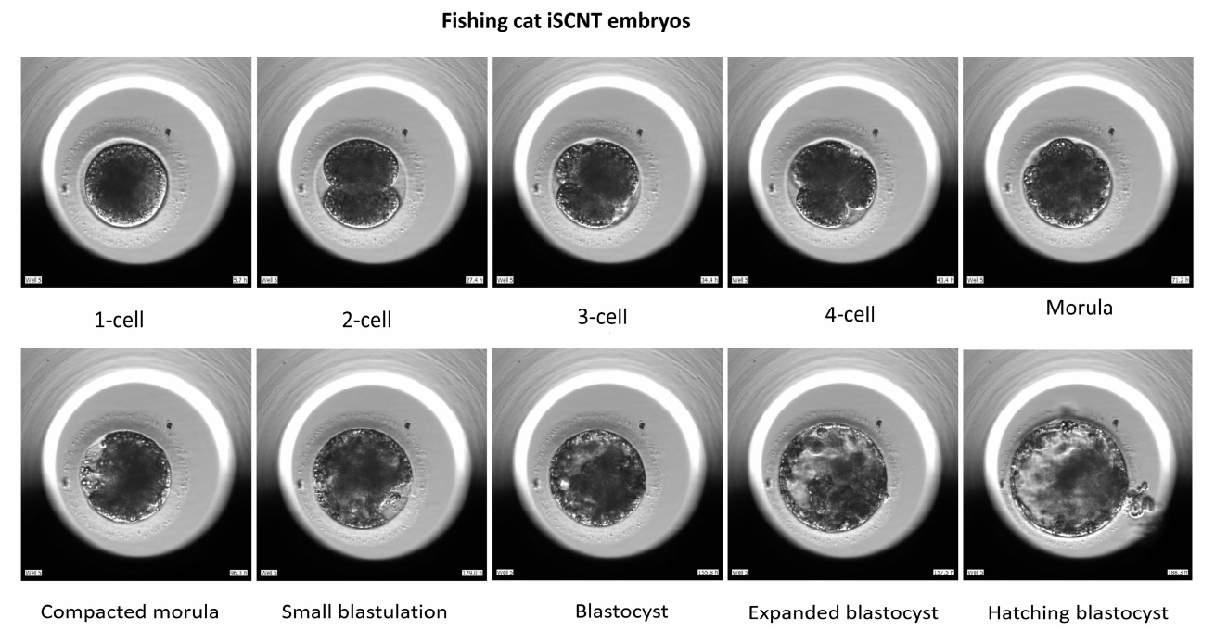
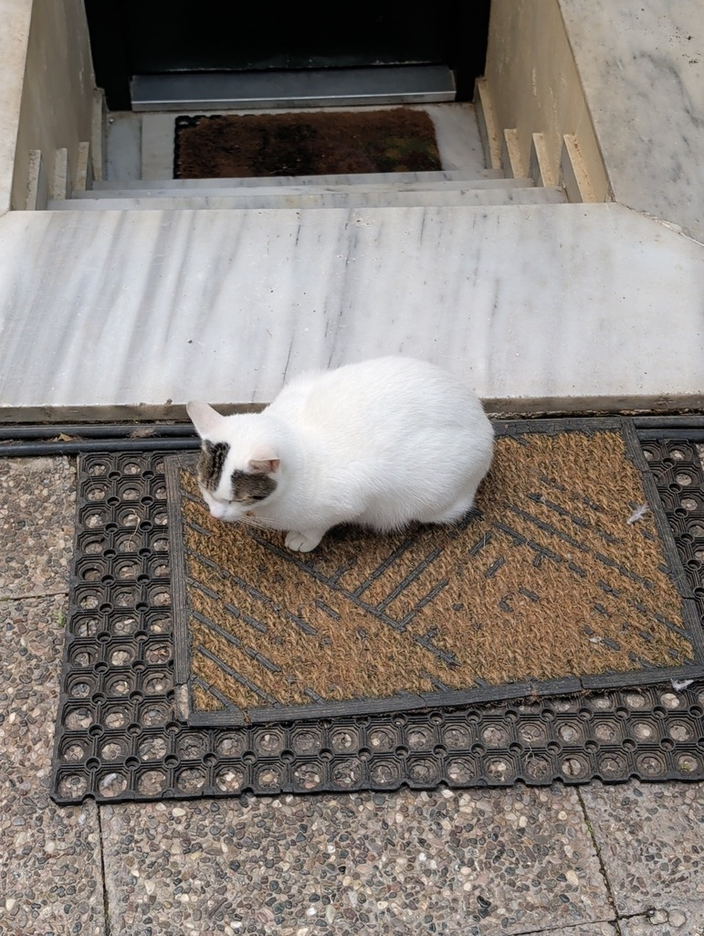
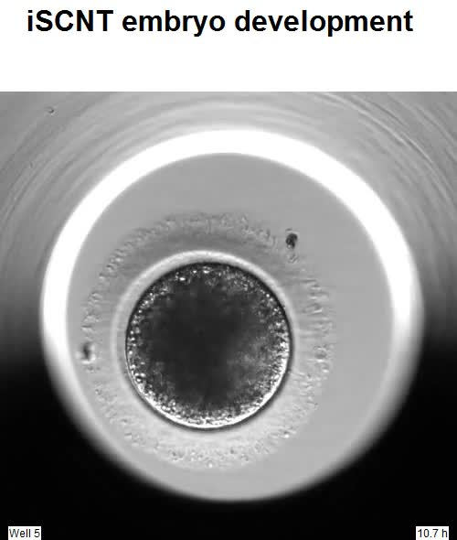
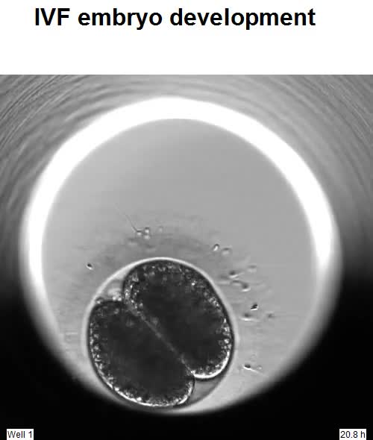
Feline imaging follows embryo development
Interspecies SCNT, or iSCNT, combines a donor nucleus and recipient oocyte from different species. The feline study used fishing-cat donor cells and domestic-cat oocytes. Domestic-cat embryos produced by in vitro fertilization supplied a comparison. A time-lapse system recorded development from the one-cell stage. The recordings preserved successive divisions and changes in embryo organization.
Morphokinetics describes the timing and visible sequence of developmental events. A single endpoint can miss abnormal divisions that occurred earlier. Repeated imaging reveals when cells divide and how the embryo changes between divisions. The study compared these trajectories across embryo preparations. Developmental assessment consequently included both appearance and temporal history.
The iSCNT embryos developed less efficiently to morulae and blastocysts than the IVF controls. Many early developmental events were also delayed. A morula is a compact multicellular embryo preceding blastocyst formation. The transition involves changes in cell arrangement as well as increasing cell number. Following that transition connected early cleavage behavior with later developmental progression.
Liu et al. (2025), Fig. 1. Developmental stages of fishing cat–domestic cat iSCNT embryos.
Photo: Felis catus. Austin Hemmelgarn. CC BY 4.0.
Liu (2025), Video S1. Fishing-cat iSCNT development.
Liu (2025), Video S2. Domestic-cat IVF development.
Liu et al. (2025)
25
Notes:
• **Interspecies SCNT**, or iSCNT, combines a donor nucleus and recipient oocyte from different species. The feline study used fishing-cat donor cells and domestic-cat oocytes. Domestic-cat embryos produced by in vitro fertilization supplied a comparison. A time-lapse system recorded development from the one-cell stage. The recordings preserved successive divisions and changes in embryo organization.
• **Morphokinetics** describes the timing and visible sequence of developmental events. A single endpoint can miss abnormal divisions that occurred earlier. Repeated imaging reveals when cells divide and how the embryo changes between divisions. The study compared these trajectories across embryo preparations. Developmental assessment consequently included both appearance and temporal history.
• The iSCNT embryos developed less efficiently to morulae and blastocysts than the IVF controls. Many early developmental events were also delayed. A **morula** is a compact multicellular embryo preceding blastocyst formation. The transition involves changes in cell arrangement as well as increasing cell number. Following that transition connected early cleavage behavior with later developmental progression.
References:
Liu HJ, Oh SJWY, Tay NL, Lim CY, Hsu CD, Chua DHH, Teo WKL, Loh YH, Ng SC (2025). Morphokinetic Analyses of Fishing Cat-Domestic Cat Interspecies Somatic Cell Nuclear Transfer Embryos Through A Time-Lapse System. Animals : an open access journal from MDPI 15(2):148. https://doi.org/10.3390/ani15020148
Figure: Liu et al. (2025), Fig. 1. Developmental stages of fishing cat–domestic cat iSCNT embryos.
Figure source: https://doi.org/10.3390/ani15020148
Image: Photo: Felis catus. Credit: (c) Austin Hemmelgarn, some rights reserved (CC BY). License: CC BY 4.0. Source: https://www.inaturalist.org/observations/410037590
Embedded video: Liu (2025), Video S1. Fishing-cat iSCNT development.
Article: Liu HJ, Oh SJWY, Tay NL, Lim CY, Hsu CD, Chua DHH, Teo WKL, Loh YH, Ng SC. (2025). Morphokinetic Analyses of Fishing Cat-Domestic Cat Interspecies Somatic Cell Nuclear Transfer Embryos Through A Time-Lapse System. Animals : an open access journal from MDPI 15:148. https://doi.org/10.3390/ani15020148
Exact source filename: Video S1. Iscnt Development.m4v
Original media/source page: https://www.ebi.ac.uk/europepmc/webservices/rest/PMC11758314/supplementaryFiles
Original source hash: 27aaf5fd02e65ee100b135513ecf58e8400875837e8c372464d4867ce5977cd7
Embedded clip hash: f0681c8e2d0e55e297bf3e94244e5ce746a11b9694b60ba54fe764660336c484
Source recording interval: 0.000–41.200 s. Original scientific frames, proportions, author-provided timing and available audio retained. Playback seconds are not necessarily biological elapsed time in source time-lapse/accelerated films.
License: https://creativecommons.org/licenses/by/4.0/ Licensee MDPI, Basel, Switzerland. This article is an open access article distributed under the terms and conditions of the Creative Commons Attribution (CC BY) license ( https://creativecommons.org/licenses/by/4.0/ ).
Native PPTX movie object with a separate static poster fallback. Desktop PowerPoint GUI playback and Google Slides import have not been tested. Google Slides may require inserting the supplied MP4 from Drive after import.
Embedded video: Liu (2025), Video S2. Domestic-cat IVF development.
Article: Liu HJ, Oh SJWY, Tay NL, Lim CY, Hsu CD, Chua DHH, Teo WKL, Loh YH, Ng SC. (2025). Morphokinetic Analyses of Fishing Cat-Domestic Cat Interspecies Somatic Cell Nuclear Transfer Embryos Through A Time-Lapse System. Animals : an open access journal from MDPI 15:148. https://doi.org/10.3390/ani15020148
Exact source filename: Video S2. Ivf Embryo Develpment.m4v
Original media/source page: https://www.ebi.ac.uk/europepmc/webservices/rest/PMC11758314/supplementaryFiles
Original source hash: dd304452e0d5c3f810358f460f7eda4214c60bdd16e2304bfbe968e7066d7673
Embedded clip hash: cec54e9306c9ab49487a6173e553e9349983e07aa3ff738932a33ac7fb5eb28e
Source recording interval: 0.000–38.250 s. Original scientific frames, proportions, author-provided timing and available audio retained. Playback seconds are not necessarily biological elapsed time in source time-lapse/accelerated films.
License: https://creativecommons.org/licenses/by/4.0/ Licensee MDPI, Basel, Switzerland. This article is an open access article distributed under the terms and conditions of the Creative Commons Attribution (CC BY) license ( https://creativecommons.org/licenses/by/4.0/ ).
Native PPTX movie object with a separate static poster fallback. Desktop PowerPoint GUI playback and Google Slides import have not been tested. Google Slides may require inserting the supplied MP4 from Drive after import.

Slide 26

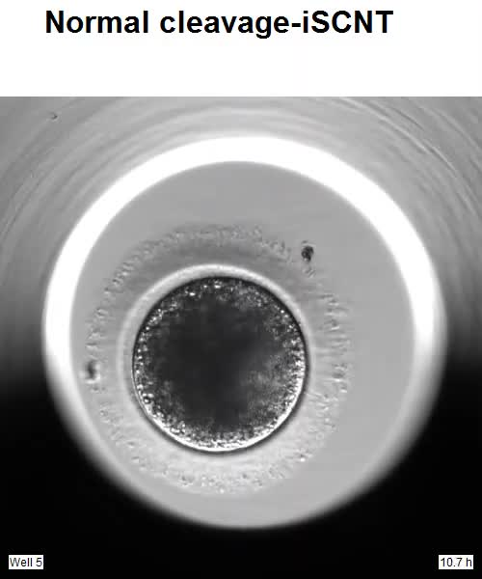
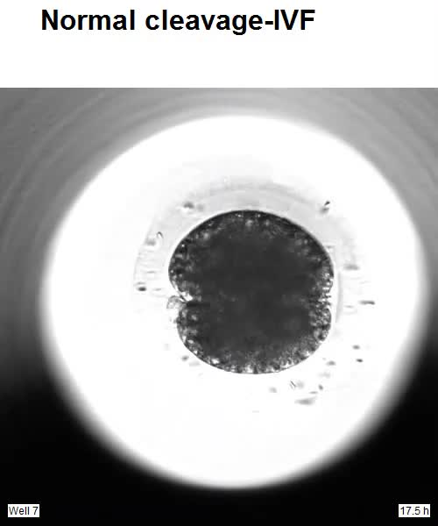
Normal first cleavage produces two cells
A normal first cleavage divides a one-cell embryo into two blastomeres. The feline time-lapse recordings followed this event directly. Both reconstructed embryos and IVF embryos could be examined. Their trajectories could then be related to later development. The same endpoint cell count could be interpreted through its recorded history.
The study compared normal cleavage with alternative division patterns. Embryos following normal cleavage more often reached the blastocyst stage than those with direct cleavage. Early division pattern therefore carried information about subsequent development. This relationship concerned an observed developmental trajectory. It was not based solely on how an embryo appeared at one later inspection.
Cell division must coordinate chromosome segregation with physical separation of the cell. Successful cleavage preserves a developing cellular organization. The first two blastomeres share the embryo’s reconstructed cellular origin. Later compaction supplies another developmental event for comparison. Together these observations relate early cellular behavior to the formation of a multicellular embryo.
Liu et al. (2025), Fig. 1. Developmental stages of fishing cat–domestic cat iSCNT embryos.
Photo: Felis catus. Astra. CC BY 4.0.
Liu (2025), Video S3. Normal iSCNT cleavage.
Liu (2025), Video S6. Original short IVF cleavage time-lapse.
Liu et al. (2025)
26
Notes:
• A normal first cleavage divides a one-cell embryo into two blastomeres. The feline time-lapse recordings followed this event directly. Both reconstructed embryos and IVF embryos could be examined. Their trajectories could then be related to later development. The same endpoint cell count could be interpreted through its recorded history.
• The study compared normal cleavage with alternative division patterns. Embryos following normal cleavage more often reached the blastocyst stage than those with direct cleavage. Early division pattern therefore carried information about subsequent development. This relationship concerned an observed developmental trajectory. It was not based solely on how an embryo appeared at one later inspection.
• Cell division must coordinate chromosome segregation with physical separation of the cell. Successful cleavage preserves a developing cellular organization. The first two blastomeres share the embryo’s reconstructed cellular origin. Later compaction supplies another developmental event for comparison. Together these observations relate early cellular behavior to the formation of a multicellular embryo.
References:
Liu HJ, Oh SJWY, Tay NL, Lim CY, Hsu CD, Chua DHH, Teo WKL, Loh YH, Ng SC (2025). Morphokinetic Analyses of Fishing Cat-Domestic Cat Interspecies Somatic Cell Nuclear Transfer Embryos Through A Time-Lapse System. Animals : an open access journal from MDPI 15(2):148. https://doi.org/10.3390/ani15020148
Figure: Liu et al. (2025), Fig. 1. Developmental stages of fishing cat–domestic cat iSCNT embryos.
Figure source: https://doi.org/10.3390/ani15020148
Image: Photo: Felis catus. Credit: (c) Astra, some rights reserved (CC BY). License: CC BY 4.0. Source: https://www.inaturalist.org/observations/70268076
Embedded video: Liu (2025), Video S3. Normal iSCNT cleavage.
Article: Liu HJ, Oh SJWY, Tay NL, Lim CY, Hsu CD, Chua DHH, Teo WKL, Loh YH, Ng SC. (2025). Morphokinetic Analyses of Fishing Cat-Domestic Cat Interspecies Somatic Cell Nuclear Transfer Embryos Through A Time-Lapse System. Animals : an open access journal from MDPI 15:148. https://doi.org/10.3390/ani15020148
Exact source filename: Video S3. Normal cleavage-iSCNT.mp4
Original media/source page: https://www.ebi.ac.uk/europepmc/webservices/rest/PMC11758314/supplementaryFiles
Original source hash: eb52e958df402dab376b3a761de837434d9c412465f6598f74a2dca8510c4426
Embedded clip hash: 54e294d14d33db7fc400e162281534f670d6ff91a57a4b141e1179769ef18f56
Source recording interval: 0.000–4.067 s. Original scientific frames, proportions, author-provided timing and available audio retained. Playback seconds are not necessarily biological elapsed time in source time-lapse/accelerated films.
License: https://creativecommons.org/licenses/by/4.0/ Licensee MDPI, Basel, Switzerland. This article is an open access article distributed under the terms and conditions of the Creative Commons Attribution (CC BY) license ( https://creativecommons.org/licenses/by/4.0/ ).
Native PPTX movie object with a separate static poster fallback. Desktop PowerPoint GUI playback and Google Slides import have not been tested. Google Slides may require inserting the supplied MP4 from Drive after import.
Embedded video: Liu (2025), Video S6. Original short IVF cleavage time-lapse.
Article: Liu HJ, Oh SJWY, Tay NL, Lim CY, Hsu CD, Chua DHH, Teo WKL, Loh YH, Ng SC. (2025). Morphokinetic Analyses of Fishing Cat-Domestic Cat Interspecies Somatic Cell Nuclear Transfer Embryos Through A Time-Lapse System. Animals : an open access journal from MDPI 15:148. https://doi.org/10.3390/ani15020148
Exact source filename: Video S6. Normal cleavage-IVF.mp4
Original media/source page: https://www.ebi.ac.uk/europepmc/webservices/rest/PMC11758314/supplementaryFiles
Original source hash: 26bb9bcf6554aa6a6f08774c393ed76ecd100a808f647be08e68632f25cad7ac
Embedded clip hash: de451e419dbf79bf7290f686b03547b45f5c70ba90d2cc355edad183f04fa6f9
Source recording interval: 0.000–1.000 s. Original scientific frames, proportions, author-provided timing and available audio retained. Playback seconds are not necessarily biological elapsed time in source time-lapse/accelerated films.
License: https://creativecommons.org/licenses/by/4.0/ Licensee MDPI, Basel, Switzerland. This article is an open access article distributed under the terms and conditions of the Creative Commons Attribution (CC BY) license ( https://creativecommons.org/licenses/by/4.0/ ).
Native PPTX movie object with a separate static poster fallback. Desktop PowerPoint GUI playback and Google Slides import have not been tested. Google Slides may require inserting the supplied MP4 from Drive after import.

Slide 27

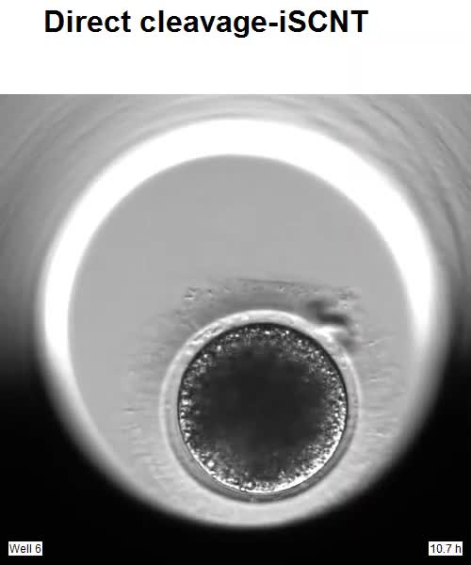
Direct cleavage changes developmental paths
Direct cleavage describes an abnormal first division producing more than two blastomeres. The feline study identified this pattern through time-lapse monitoring. It occurred more often in iSCNT embryos than in domestic-cat IVF controls. Embryos with this pattern had lower subsequent blastocyst development. The sequence of division therefore mattered beyond the number of cells eventually counted.
Time-lapse observation distinguishes a direct division from two ordinary divisions occurring close together. These histories can produce superficially similar cell counts. Recording the sequence preserves the distinction. The original study linked those histories with later outcomes. Developmental selection could consequently consider the path by which an embryo reached its current appearance.
A reconstructed embryo begins with a manipulated nucleus and recipient cytoplasm. Its first divisions require these components to act together. An abnormal cleavage pattern records a disturbance in that coordinated process. Later development tests how far the embryo can progress afterward. The study connects a visible early event with the probability of subsequent developmental advancement.
Liu et al. (2025), Fig. 1. Developmental stages of fishing cat–domestic cat iSCNT embryos.
Photo: Felis catus. no rights reserved. CC0 1.0.
Liu (2025), Video S4. Direct iSCNT cleavage.
Liu et al. (2025)
27
Notes:
• **Direct cleavage** describes an abnormal first division producing more than two blastomeres. The feline study identified this pattern through time-lapse monitoring. It occurred more often in iSCNT embryos than in domestic-cat IVF controls. Embryos with this pattern had lower subsequent blastocyst development. The sequence of division therefore mattered beyond the number of cells eventually counted.
• Time-lapse observation distinguishes a direct division from two ordinary divisions occurring close together. These histories can produce superficially similar cell counts. Recording the sequence preserves the distinction. The original study linked those histories with later outcomes. Developmental selection could consequently consider the path by which an embryo reached its current appearance.
• A reconstructed embryo begins with a manipulated nucleus and recipient cytoplasm. Its first divisions require these components to act together. An abnormal cleavage pattern records a disturbance in that coordinated process. Later development tests how far the embryo can progress afterward. The study connects a visible early event with the probability of subsequent developmental advancement.
References:
Liu HJ, Oh SJWY, Tay NL, Lim CY, Hsu CD, Chua DHH, Teo WKL, Loh YH, Ng SC (2025). Morphokinetic Analyses of Fishing Cat-Domestic Cat Interspecies Somatic Cell Nuclear Transfer Embryos Through A Time-Lapse System. Animals : an open access journal from MDPI 15(2):148. https://doi.org/10.3390/ani15020148
Figure: Liu et al. (2025), Fig. 1. Developmental stages of fishing cat–domestic cat iSCNT embryos.
Figure source: https://doi.org/10.3390/ani15020148
Image: Photo: Felis catus. Credit: no rights reserved. License: CC0 1.0. Source: https://www.inaturalist.org/observations/410024087
Embedded video: Liu (2025), Video S4. Direct iSCNT cleavage.
Article: Liu HJ, Oh SJWY, Tay NL, Lim CY, Hsu CD, Chua DHH, Teo WKL, Loh YH, Ng SC. (2025). Morphokinetic Analyses of Fishing Cat-Domestic Cat Interspecies Somatic Cell Nuclear Transfer Embryos Through A Time-Lapse System. Animals : an open access journal from MDPI 15:148. https://doi.org/10.3390/ani15020148
Exact source filename: Video S4. Direct cleavage -iSCNT.mp4
Original media/source page: https://www.ebi.ac.uk/europepmc/webservices/rest/PMC11758314/supplementaryFiles
Original source hash: b276d494b363b4f531e23513239e85a983926c90df17610a8ea6d409aceef726
Embedded clip hash: de34942739a1cb50bdba1abbf20f08e479a56f90c28020aa643a1a07baa7087d
Source recording interval: 0.000–6.100 s. Original scientific frames, proportions, author-provided timing and available audio retained. Playback seconds are not necessarily biological elapsed time in source time-lapse/accelerated films.
License: https://creativecommons.org/licenses/by/4.0/ Licensee MDPI, Basel, Switzerland. This article is an open access article distributed under the terms and conditions of the Creative Commons Attribution (CC BY) license ( https://creativecommons.org/licenses/by/4.0/ ).
Native PPTX movie object with a separate static poster fallback. Desktop PowerPoint GUI playback and Google Slides import have not been tested. Google Slides may require inserting the supplied MP4 from Drive after import.

Slide 28
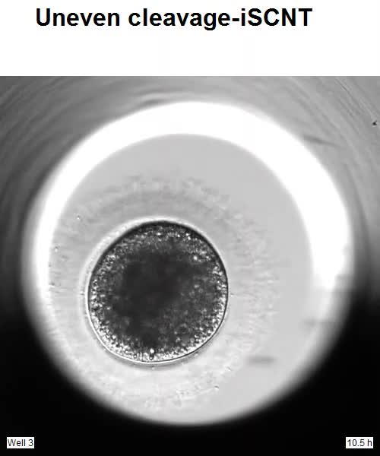
Uneven cleavage differs from compaction
The feline recordings also included uneven cleavage. Uneven cleavage produces blastomeres with visibly unequal sizes. It differs from direct cleavage, which concerns the number produced in a division. Time-lapse observation preserves both properties. An embryo’s developmental history can therefore include more than one kind of morphological feature.
Compaction occurs when blastomeres establish a more tightly integrated multicellular arrangement. In the feline study, iSCNT embryos that later reached blastocysts were more likely to compact as morulae. They also differed in developmental timing from embryos that arrested. Their trajectory therefore combined division history with later cell organization. Both were measurable during continuous monitoring.
The terms describe events at different levels of organization. Cleavage partitions a cell into blastomeres. Compaction reorganizes contacts among the resulting cells. The transition toward a blastocyst requires further coordination of those cells. Following several events provides a developmental account richer than a single morphological grade.
Liu et al. (2025), Fig. 1. Developmental stages of fishing cat–domestic cat iSCNT embryos.
Liu (2025), Video S5. Uneven iSCNT cleavage.
Liu et al. (2025)
28
Notes:
• The feline recordings also included uneven cleavage. **Uneven cleavage** produces blastomeres with visibly unequal sizes. It differs from direct cleavage, which concerns the number produced in a division. Time-lapse observation preserves both properties. An embryo’s developmental history can therefore include more than one kind of morphological feature.
• **Compaction** occurs when blastomeres establish a more tightly integrated multicellular arrangement. In the feline study, iSCNT embryos that later reached blastocysts were more likely to compact as morulae. They also differed in developmental timing from embryos that arrested. Their trajectory therefore combined division history with later cell organization. Both were measurable during continuous monitoring.
• The terms describe events at different levels of organization. Cleavage partitions a cell into blastomeres. Compaction reorganizes contacts among the resulting cells. The transition toward a blastocyst requires further coordination of those cells. Following several events provides a developmental account richer than a single morphological grade.
References:
Liu HJ, Oh SJWY, Tay NL, Lim CY, Hsu CD, Chua DHH, Teo WKL, Loh YH, Ng SC (2025). Morphokinetic Analyses of Fishing Cat-Domestic Cat Interspecies Somatic Cell Nuclear Transfer Embryos Through A Time-Lapse System. Animals : an open access journal from MDPI 15(2):148. https://doi.org/10.3390/ani15020148
Figure: Liu et al. (2025), Fig. 1. Developmental stages of fishing cat–domestic cat iSCNT embryos.
Figure source: https://doi.org/10.3390/ani15020148
Embedded video: Liu (2025), Video S5. Uneven iSCNT cleavage.
Article: Liu HJ, Oh SJWY, Tay NL, Lim CY, Hsu CD, Chua DHH, Teo WKL, Loh YH, Ng SC. (2025). Morphokinetic Analyses of Fishing Cat-Domestic Cat Interspecies Somatic Cell Nuclear Transfer Embryos Through A Time-Lapse System. Animals : an open access journal from MDPI 15:148. https://doi.org/10.3390/ani15020148
Exact source filename: Video S5. Uneven cleavage-iSCNT.mp4
Original media/source page: https://www.ebi.ac.uk/europepmc/webservices/rest/PMC11758314/supplementaryFiles
Original source hash: f9cb45742b6662803bf0c1d1fa07ecbb81d4a2196f08eb16d52552db73f2b5ac
Embedded clip hash: dd8776302f41484810e090011736d9d21aad97319219b0e428c44540eaa37bc2
Source recording interval: 0.000–4.033 s. Original scientific frames, proportions, author-provided timing and available audio retained. Playback seconds are not necessarily biological elapsed time in source time-lapse/accelerated films.
License: https://creativecommons.org/licenses/by/4.0/ Licensee MDPI, Basel, Switzerland. This article is an open access article distributed under the terms and conditions of the Creative Commons Attribution (CC BY) license ( https://creativecommons.org/licenses/by/4.0/ ).
Native PPTX movie object with a separate static poster fallback. Desktop PowerPoint GUI playback and Google Slides import have not been tested. Google Slides may require inserting the supplied MP4 from Drive after import.

Slide 29
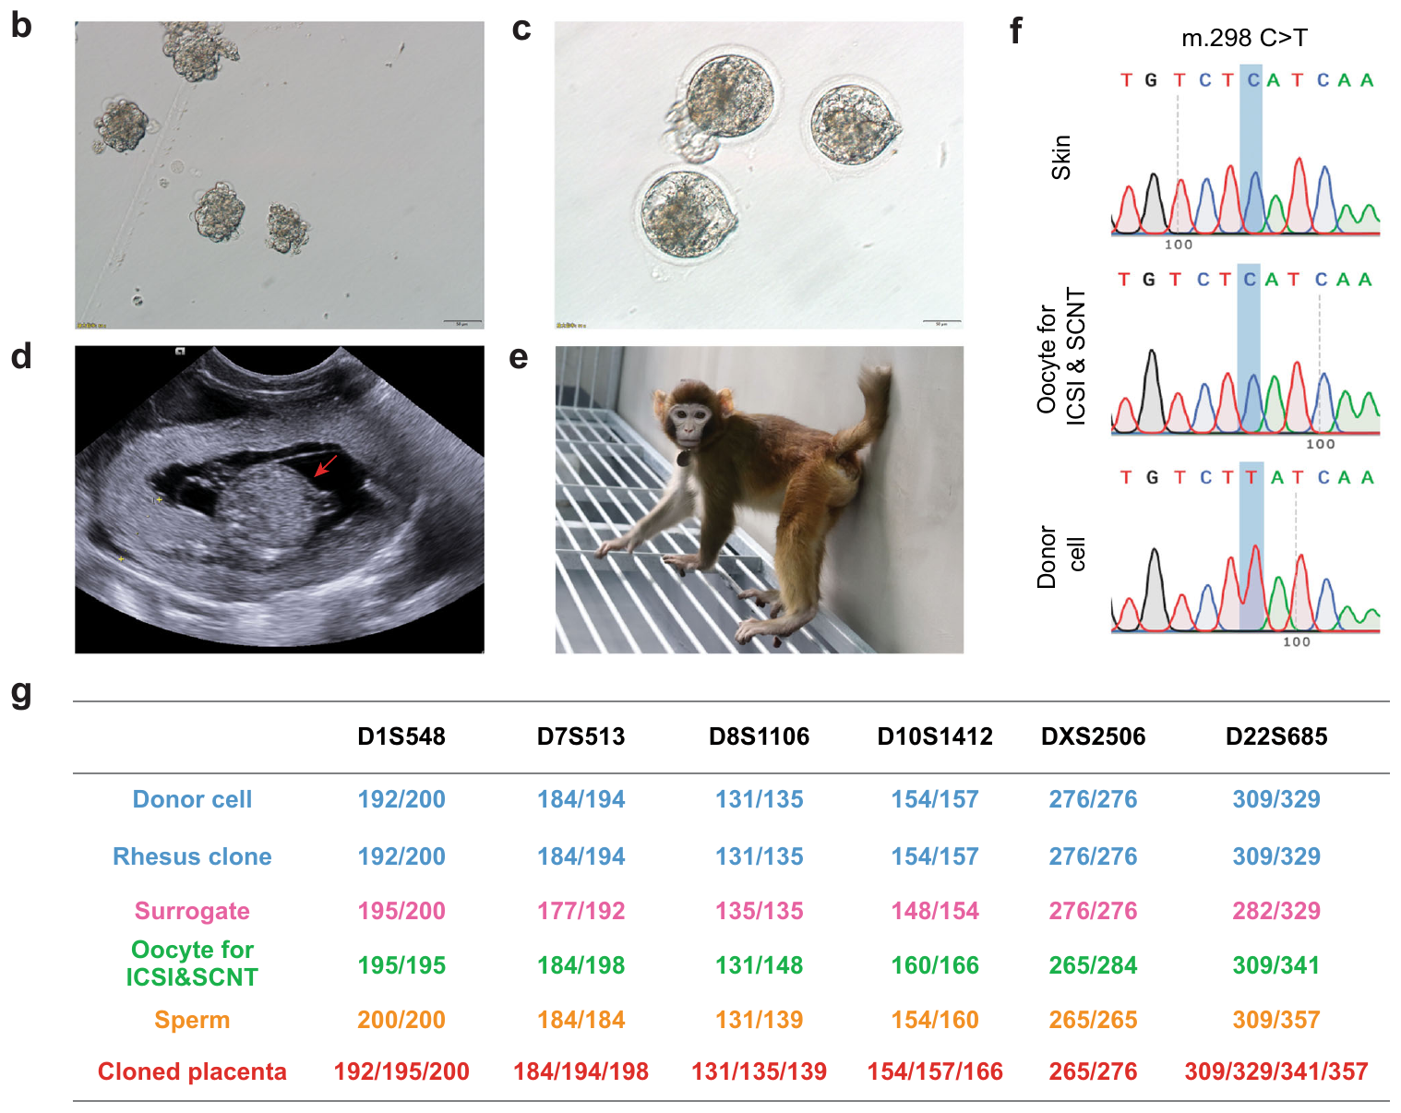

Rhesus cloning exposes a placental barrier
A mammalian embryo produces both the developing animal and supporting extraembryonic tissues. Extraembryonic tissues contribute to structures such as the placenta. Liao and colleagues studied developmental problems in rhesus monkey SCNT. They examined epigenetic states and postimplantation outcomes. The placental contribution emerged as an important component of the cloning problem.
The placenta supports exchange between the developing conceptus and the maternal circulation. Its development depends partly on the embryo’s trophoblast lineage. Reconstructed embryos can reach early stages yet encounter later difficulties. The monkey study therefore extended assessment beyond blastocyst formation. It connected molecular reprogramming with the functioning of a distinct developmental lineage.
An embryo and its supporting tissues do not perform identical functions. Their developmental requirements can also differ. Studying the placenta separates one source of developmental failure from the embryonic tissues themselves. This distinction motivated an intervention directed at the supporting lineage. Nuclear cloning could consequently be investigated through the contributions of specific embryonic compartments.
Liao et al. (2024), Fig. 6(b–g). Reconstructed embryos, cloned rhesus macaque and genetic identity measurements.
Photo: rhesus macaque, Macaca mulatta. Donald Hobern. CC BY 4.0.
Liao et al. (2024)
29
Notes:
• A mammalian embryo produces both the developing animal and supporting extraembryonic tissues. **Extraembryonic** tissues contribute to structures such as the placenta. Liao and colleagues studied developmental problems in rhesus monkey SCNT. They examined epigenetic states and postimplantation outcomes. The placental contribution emerged as an important component of the cloning problem.
• The **placenta** supports exchange between the developing conceptus and the maternal circulation. Its development depends partly on the embryo’s trophoblast lineage. Reconstructed embryos can reach early stages yet encounter later difficulties. The monkey study therefore extended assessment beyond blastocyst formation. It connected molecular reprogramming with the functioning of a distinct developmental lineage.
• An embryo and its supporting tissues do not perform identical functions. Their developmental requirements can also differ. Studying the placenta separates one source of developmental failure from the embryonic tissues themselves. This distinction motivated an intervention directed at the supporting lineage. Nuclear cloning could consequently be investigated through the contributions of specific embryonic compartments.
References:
Liao Z, Zhang J, Sun S, Li Y, Xu Y, Li C, Cao J, Nie Y, Niu Z, Liu J, Lu F, Liu Z, Sun Q (2024). Reprogramming mechanism dissection and trophoblast replacement application in monkey somatic cell nuclear transfer. Nature communications 15(1):5. https://doi.org/10.1038/s41467-023-43985-7
Figure: Liao et al. (2024), Fig. 6(b–g). Reconstructed embryos, cloned rhesus macaque and genetic identity measurements.
Figure source: https://doi.org/10.1038/s41467-023-43985-7
Image: Photo: rhesus macaque, Macaca mulatta. Credit: (c) Donald Hobern, some rights reserved (CC BY). License: CC BY 4.0. Source: https://www.inaturalist.org/observations/2360798

Slide 30

Imprinting depends on developmental history
Genomic imprinting is parent-of-origin-dependent regulation of particular genes. It is associated with epigenetic marks rather than a different DNA sequence at every gene. The rhesus study examined imprinting-related differences in SCNT embryos. Some epigenetic abnormalities persisted after implantation. Reaching a blastocyst therefore did not guarantee complete correction of these regulatory states.
DNA methylation is a chemical modification of DNA involved in gene regulation. Its distribution can differ between parental genomes and developmental stages. Somatic donor nuclei enter reconstruction with a history different from that of gametes. The study traced abnormal methylation and gene-expression patterns through development. Molecular state could therefore be related to later developmental performance.
Persistent regulation in supporting tissues can influence the whole conceptus. The placenta must develop and function while the embryo grows. A regulatory difference in that lineage can consequently affect later outcomes. The monkey experiments connected epigenetic history with lineage-specific development. They treated successful reprogramming as a coordinated developmental process rather than a single molecular switch.
Liao et al. (2024), Fig. 6(b–g). Reconstructed embryos, cloned rhesus macaque and genetic identity measurements.
Photo: rhesus macaque, Macaca mulatta. Rejoice Gassah. CC BY 4.0.
Liao et al. (2024)
30
Notes:
• **Genomic imprinting** is parent-of-origin-dependent regulation of particular genes. It is associated with epigenetic marks rather than a different DNA sequence at every gene. The rhesus study examined imprinting-related differences in SCNT embryos. Some epigenetic abnormalities persisted after implantation. Reaching a blastocyst therefore did not guarantee complete correction of these regulatory states.
• **DNA methylation** is a chemical modification of DNA involved in gene regulation. Its distribution can differ between parental genomes and developmental stages. Somatic donor nuclei enter reconstruction with a history different from that of gametes. The study traced abnormal methylation and gene-expression patterns through development. Molecular state could therefore be related to later developmental performance.
• Persistent regulation in supporting tissues can influence the whole conceptus. The placenta must develop and function while the embryo grows. A regulatory difference in that lineage can consequently affect later outcomes. The monkey experiments connected epigenetic history with lineage-specific development. They treated successful reprogramming as a coordinated developmental process rather than a single molecular switch.
References:
Liao Z, Zhang J, Sun S, Li Y, Xu Y, Li C, Cao J, Nie Y, Niu Z, Liu J, Lu F, Liu Z, Sun Q (2024). Reprogramming mechanism dissection and trophoblast replacement application in monkey somatic cell nuclear transfer. Nature communications 15(1):5. https://doi.org/10.1038/s41467-023-43985-7
Figure: Liao et al. (2024), Fig. 6(b–g). Reconstructed embryos, cloned rhesus macaque and genetic identity measurements.
Figure source: https://doi.org/10.1038/s41467-023-43985-7
Image: Photo: rhesus macaque, Macaca mulatta. Credit: (c) Rejoice Gassah, some rights reserved (CC BY). License: CC BY 4.0. Source: https://www.inaturalist.org/observations/300329906

Slide 31
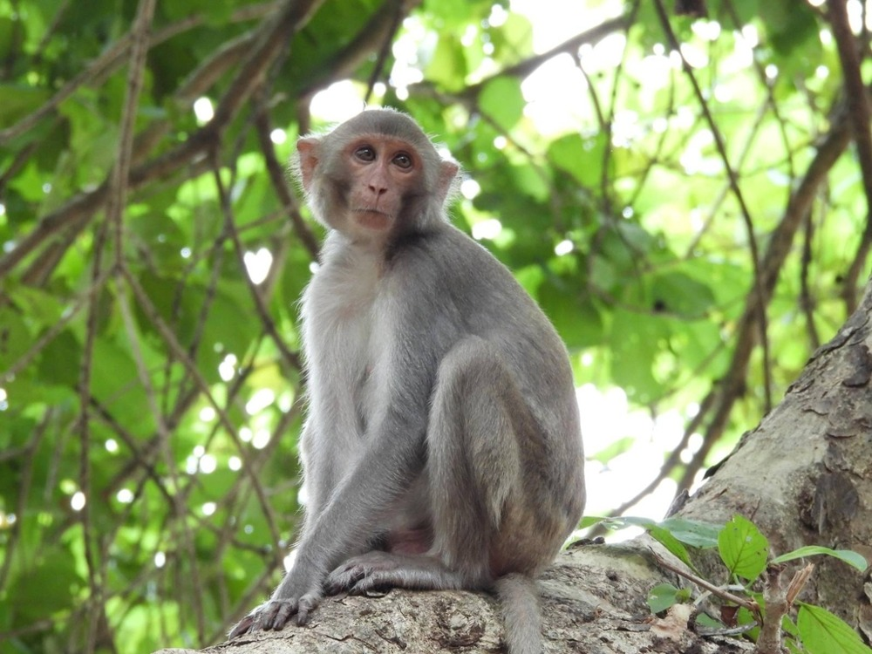
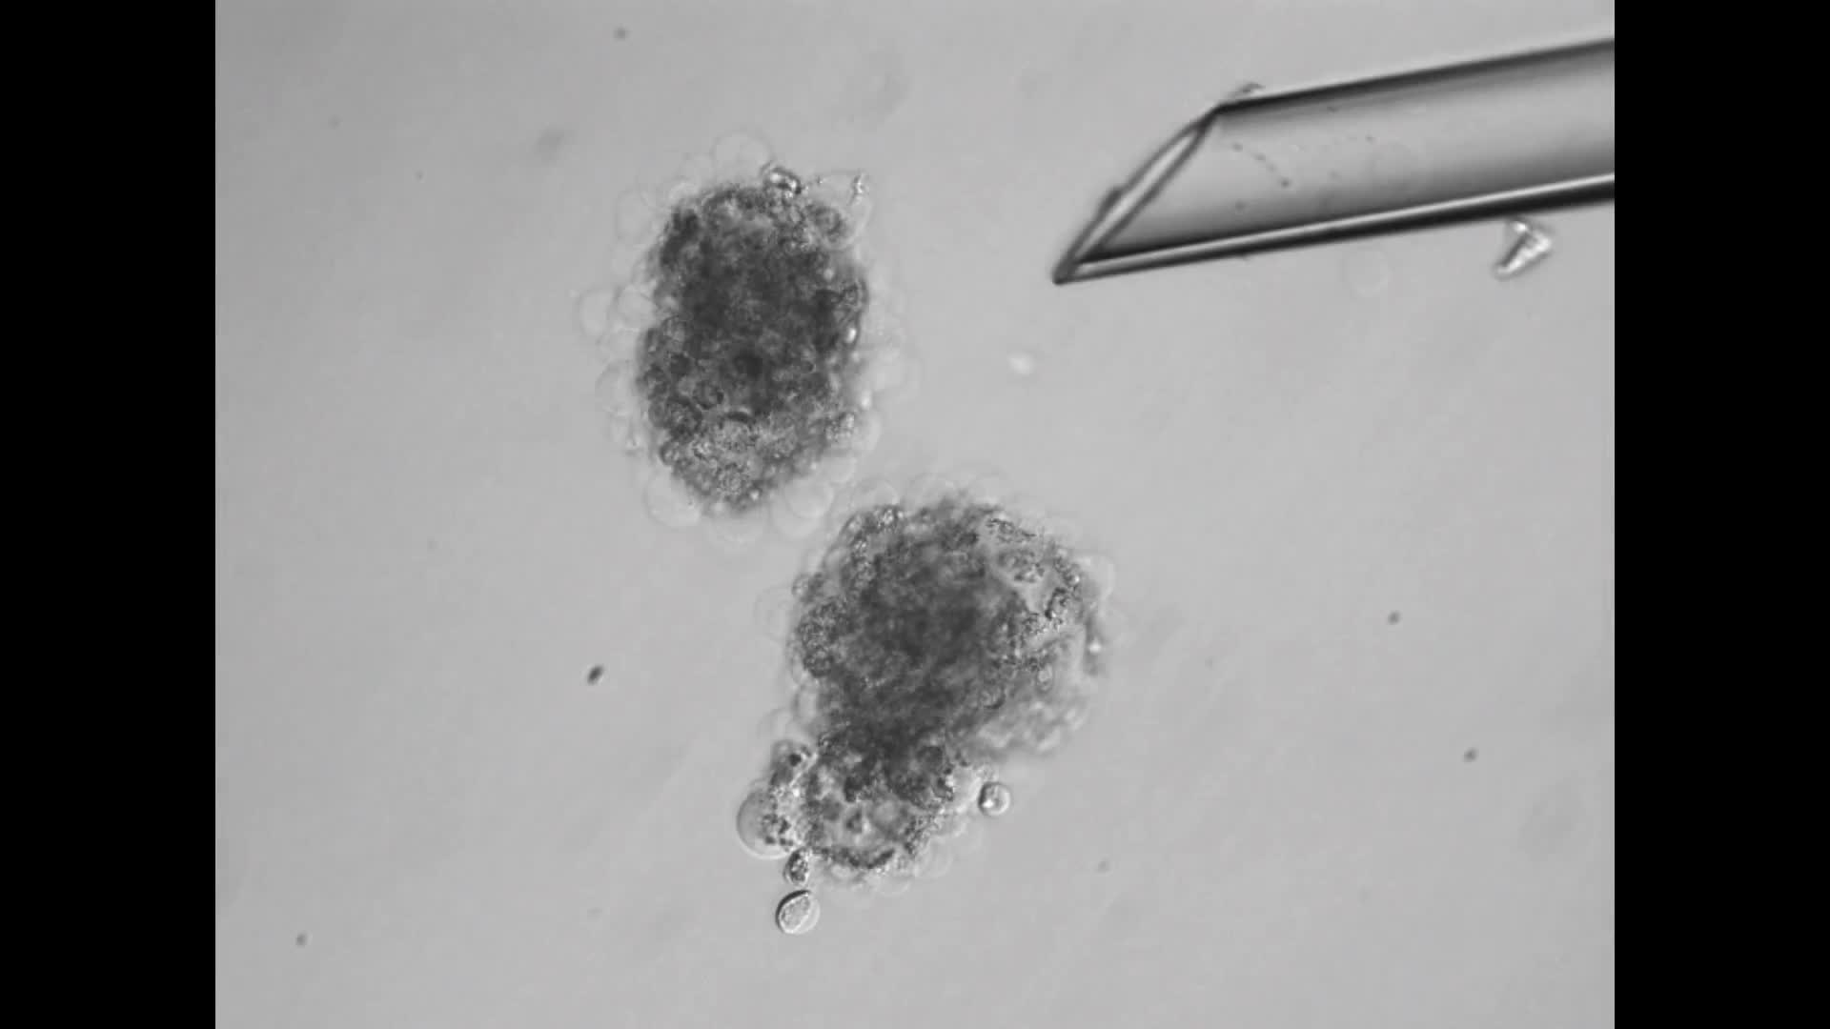
Trophoblast replacement changes support
The inner cell mass contains cells that contribute to the embryo proper. Trophoblast contributes to supporting extraembryonic tissues. The rhesus study combined an SCNT-derived inner cell mass with a fertilization-derived supporting compartment. This procedure is called trophoblast replacement. The original supplementary recording documents the reconstruction procedure.
The manipulation separated two developmental contributions that ordinarily arise together. The embryonic lineage retained its SCNT origin. The supporting trophoblast had a different origin. A reconstructed blastocyst could then be transferred for further development. This design tested whether replacing the supporting lineage could improve the outcome of the embryonic lineage.
The procedure produced a live rhesus monkey. The animal’s embryonic nuclear origin was assessed with genetic markers. Its supporting tissues also required separate characterization. The intervention therefore linked a defined lineage replacement with development to term. It connected an epigenetic developmental barrier with a targeted change in embryo organization.
Liao et al. (2024), Fig. 6(b–g). Reconstructed embryos, cloned rhesus macaque and genetic identity measurements.
Photo: rhesus macaque, Macaca mulatta. Sameer Kulkarni. CC BY 4.0.
Liao (2024), Supplementary Movie 1. Trophoblast-replacement procedure.
Liao et al. (2024)
31
Notes:
• The **inner cell mass** contains cells that contribute to the embryo proper. **Trophoblast** contributes to supporting extraembryonic tissues. The rhesus study combined an SCNT-derived inner cell mass with a fertilization-derived supporting compartment. This procedure is called trophoblast replacement. The original supplementary recording documents the reconstruction procedure.
• The manipulation separated two developmental contributions that ordinarily arise together. The embryonic lineage retained its SCNT origin. The supporting trophoblast had a different origin. A reconstructed blastocyst could then be transferred for further development. This design tested whether replacing the supporting lineage could improve the outcome of the embryonic lineage.
• The procedure produced a live rhesus monkey. The animal’s embryonic nuclear origin was assessed with genetic markers. Its supporting tissues also required separate characterization. The intervention therefore linked a defined lineage replacement with development to term. It connected an epigenetic developmental barrier with a targeted change in embryo organization.
References:
Liao Z, Zhang J, Sun S, Li Y, Xu Y, Li C, Cao J, Nie Y, Niu Z, Liu J, Lu F, Liu Z, Sun Q (2024). Reprogramming mechanism dissection and trophoblast replacement application in monkey somatic cell nuclear transfer. Nature communications 15(1):5. https://doi.org/10.1038/s41467-023-43985-7
Figure: Liao et al. (2024), Fig. 6(b–g). Reconstructed embryos, cloned rhesus macaque and genetic identity measurements.
Figure source: https://doi.org/10.1038/s41467-023-43985-7
Image: Photo: rhesus macaque, Macaca mulatta. Credit: (c) Sameer Kulkarni, some rights reserved (CC BY). License: CC BY 4.0. Source: https://www.inaturalist.org/observations/137377229
Embedded video: Liao (2024), Supplementary Movie 1. Trophoblast-replacement procedure.
Article: Liao Z, Zhang J, Sun S, Li Y, Xu Y, Li C, Cao J, Nie Y, Niu Z, Liu J, Lu F, Liu Z, Sun Q. (2024). Reprogramming mechanism dissection and trophoblast replacement application in monkey somatic cell nuclear transfer. Nature communications 15:5. https://doi.org/10.1038/s41467-023-43985-7
Exact source filename: 41467_2023_43985_MOESM4_ESM.mp4
Original media/source page: https://www.ebi.ac.uk/europepmc/webservices/rest/PMC10791636/supplementaryFiles
Original source hash: 90e91a1eb6bd2084e0fe37d87ae672704625908aedb00e9e3d30ff18e2ff0653
Embedded clip hash: e141e7fc0fe23be019d87d9a61d907817bc0498c2bd2312495e2db984a91476c
Source recording interval: 0.000–26.473 s. Original scientific frames, proportions, author-provided timing and available audio retained. Playback seconds are not necessarily biological elapsed time in source time-lapse/accelerated films.
License: https://creativecommons.org/licenses/by/4.0/ Open Access This article is licensed under a Creative Commons Attribution 4.0 International License, which permits use, sharing, adaptation, distribution and reproduction in any medium or format, as long as you give appropriate credit to the original author(s) and the source, provide a link to the Creative Commons licence, and indicate if changes were made. The images or other third party material in this article are included in the article’s Creative Commons licence, unless indicated otherwise in a credit line to the material. If material is not included in the article’s Creative Commons licence and your intended use is not permitted by statutory regulation or exceeds the permitted use, you will need to obtain permission directly from the copyright holder. To view a copy of this licence, visit http://creativecommons.org/licenses/by/4.0/ .
Native PPTX movie object with a separate static poster fallback. Desktop PowerPoint GUI playback and Google Slides import have not been tested. Google Slides may require inserting the supplied MP4 from Drive after import.

Slide 32
Markers identify reconstructed tissue origins
A reconstructed conceptus can contain contributions from several biological sources. The rhesus study compared the cloned animal with the nuclear donor and other contributors. Genetic markers are identifiable sequence variants used to distinguish those sources. Multiple markers supported assessment of nuclear origin. The investigators also examined the composition of supporting tissues.
The donor cell, recipient oocyte and surrogate mother have different roles. Nuclear DNA markers address the origin of the animal’s nuclear genome. Other measurements can address oocyte-associated contributions. Tissue sampling also distinguishes the animal from its placenta. These comparisons prevent several biological contributions from being collapsed into a single label.
The resulting animal developed through a reconstructed embryo and a recipient pregnancy. Its tissues formed during that developmental history. Identity testing connected the final animal with the intended nuclear source. Analysis of supporting tissues addressed the lineage-replacement intervention. Together the measurements linked a specific reconstruction method with its organismal outcome.
Liao et al. (2024), Fig. 6(b–g). Reconstructed embryos, cloned rhesus macaque and genetic identity measurements.
Liao et al. (2024)
32
Notes:
• A reconstructed conceptus can contain contributions from several biological sources. The rhesus study compared the cloned animal with the nuclear donor and other contributors. **Genetic markers** are identifiable sequence variants used to distinguish those sources. Multiple markers supported assessment of nuclear origin. The investigators also examined the composition of supporting tissues.
• The donor cell, recipient oocyte and surrogate mother have different roles. Nuclear DNA markers address the origin of the animal’s nuclear genome. Other measurements can address oocyte-associated contributions. Tissue sampling also distinguishes the animal from its placenta. These comparisons prevent several biological contributions from being collapsed into a single label.
• The resulting animal developed through a reconstructed embryo and a recipient pregnancy. Its tissues formed during that developmental history. Identity testing connected the final animal with the intended nuclear source. Analysis of supporting tissues addressed the lineage-replacement intervention. Together the measurements linked a specific reconstruction method with its organismal outcome.
References:
Liao Z, Zhang J, Sun S, Li Y, Xu Y, Li C, Cao J, Nie Y, Niu Z, Liu J, Lu F, Liu Z, Sun Q (2024). Reprogramming mechanism dissection and trophoblast replacement application in monkey somatic cell nuclear transfer. Nature communications 15(1):5. https://doi.org/10.1038/s41467-023-43985-7
Figure: Liao et al. (2024), Fig. 6(b–g). Reconstructed embryos, cloned rhesus macaque and genetic identity measurements.
Figure source: https://doi.org/10.1038/s41467-023-43985-7

Slide 33
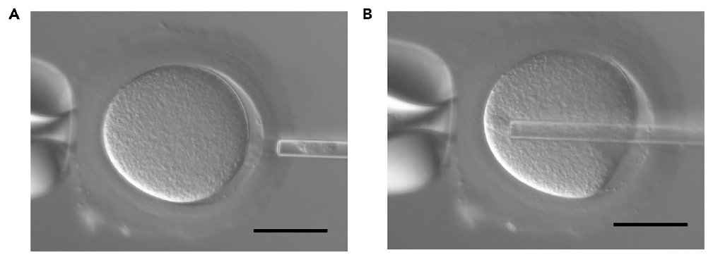

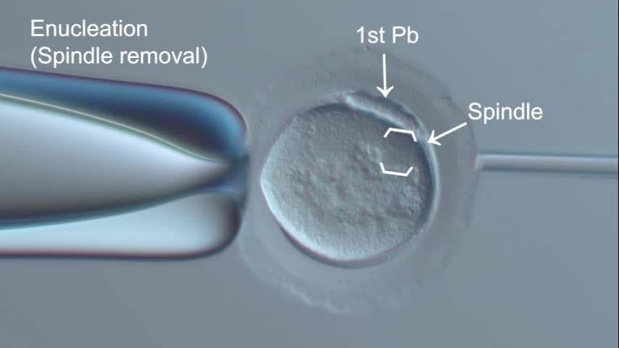
Marmoset SCNT needs a prepared oocyte
A recipient oocyte must be prepared before it receives a somatic nucleus. The marmoset protocol describes this preparation in a primate species distinct from macaques. Metaphase II is the meiotic stage at which the mature recipient oocyte is arrested. Its spindle-associated chromosomes must be identified. Removing that material produces the recipient cytoplast.
A cytoplast is a cell preparation from which the relevant nuclear material has been removed. It retains cytoplasm and cellular structures needed for reconstruction. The protocol’s recording follows removal of spindle-associated material. The first polar body is another visible landmark. This small cell-like structure is produced during oocyte maturation.
Recipient preparation must preserve the material that supports subsequent development. Removing chromosomes and damaging the whole oocyte are different interventions. The protocol documents the physical steps used to prepare a recipient. Subsequent nuclear introduction uses that prepared cellular environment. The comparative method therefore depends on species-specific oocyte handling as well as donor-cell biology.
Kurotaki et al. (2026), Fig. 7. Cumulus-nucleus isolation and injection into an enucleated marmoset oocyte.
Photo: Callithrix jacchus. Donald Davesne. CC BY 4.0.
Kurotaki (2026), Methods video S1. Marmoset oocyte enucleation.
Kurotaki et al. (2026)
33
Notes:
• A recipient oocyte must be prepared before it receives a somatic nucleus. The marmoset protocol describes this preparation in a primate species distinct from macaques. **Metaphase II** is the meiotic stage at which the mature recipient oocyte is arrested. Its spindle-associated chromosomes must be identified. Removing that material produces the recipient cytoplast.
• A **cytoplast** is a cell preparation from which the relevant nuclear material has been removed. It retains cytoplasm and cellular structures needed for reconstruction. The protocol’s recording follows removal of spindle-associated material. The first polar body is another visible landmark. This small cell-like structure is produced during oocyte maturation.
• Recipient preparation must preserve the material that supports subsequent development. Removing chromosomes and damaging the whole oocyte are different interventions. The protocol documents the physical steps used to prepare a recipient. Subsequent nuclear introduction uses that prepared cellular environment. The comparative method therefore depends on species-specific oocyte handling as well as donor-cell biology.
References:
Kurotaki Y, Yamada Y, Ogonuki N, Ogura A, Sasaki E, Matoba S (2026). Protocol for somatic cell nuclear transfer in the common marmoset. STAR protocols 7(3):104671. https://doi.org/10.1016/j.xpro.2026.104671
Figure: Kurotaki et al. (2026), Fig. 7. Cumulus-nucleus isolation and injection into an enucleated marmoset oocyte.
Figure source: https://doi.org/10.1016/j.xpro.2026.104671
Image: Photo: Callithrix jacchus. Credit: (c) Donald Davesne, some rights reserved (CC BY). License: CC BY 4.0. Source: https://www.inaturalist.org/observations/409964006
Embedded video: Kurotaki (2026), Methods video S1. Marmoset oocyte enucleation.
Article: Kurotaki Y, Yamada Y, Ogonuki N, Ogura A, Sasaki E, Matoba S. (2026). Protocol for somatic cell nuclear transfer in the common marmoset. STAR protocols 7:104671. https://doi.org/10.1016/j.xpro.2026.104671
Exact source filename: mmc1.mp4
Original media/source page: https://www.ebi.ac.uk/europepmc/webservices/rest/PMC13343152/supplementaryFiles
Original source hash: 0295fbfb33deda9fb17b5572bff0333f0d8a8b2b34ce79c09957fbc6a22d0103
Embedded clip hash: 8f66ba8c9d9d7ba762b76734188bd8eb417b998b0026357639b2a726bd4d4503
Source recording interval: 0.000–60.250 s. Original scientific frames, proportions, author-provided timing and available audio retained. Playback seconds are not necessarily biological elapsed time in source time-lapse/accelerated films.
License: This is an open access article under the CC BY-NC license (http://creativecommons.org/licenses/by-nc/4.0/).
Native PPTX movie object with a separate static poster fallback. Desktop PowerPoint GUI playback and Google Slides import have not been tested. Google Slides may require inserting the supplied MP4 from Drive after import.

Slide 34
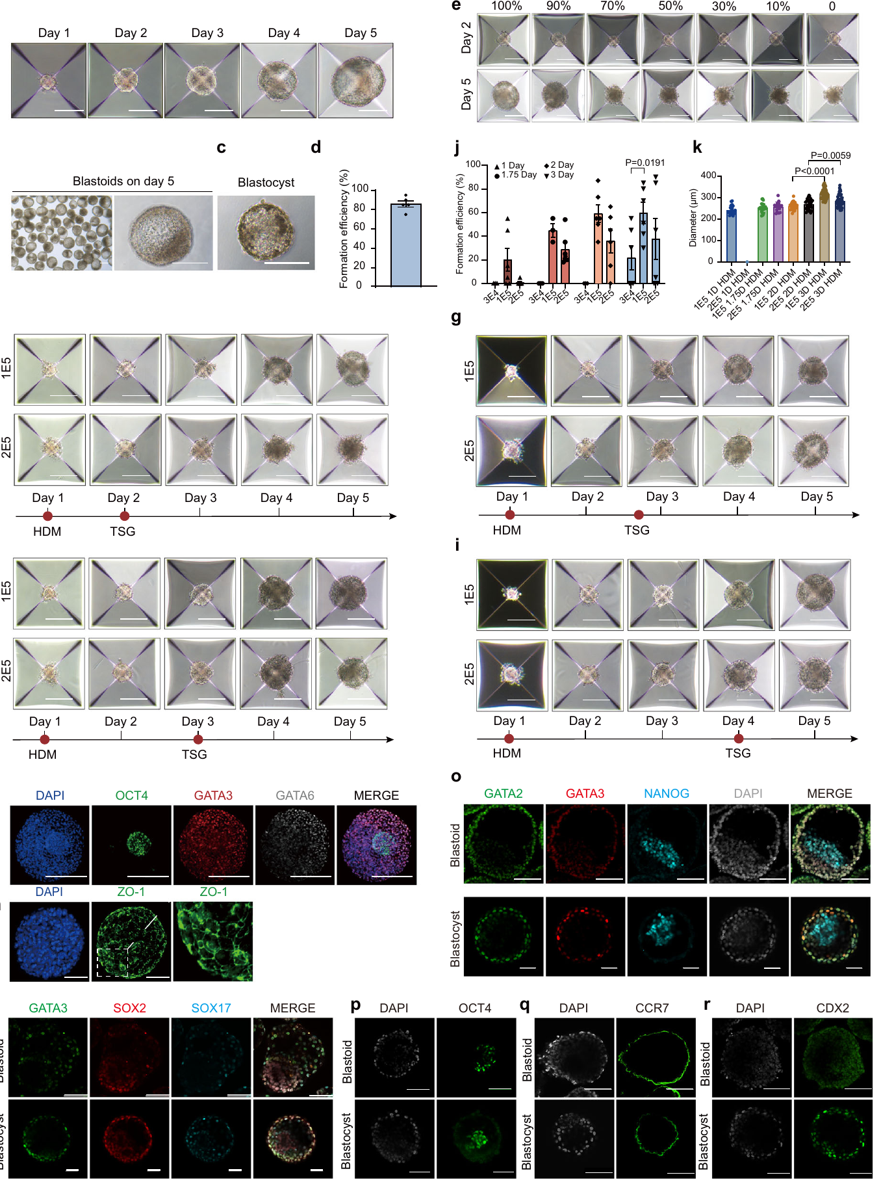
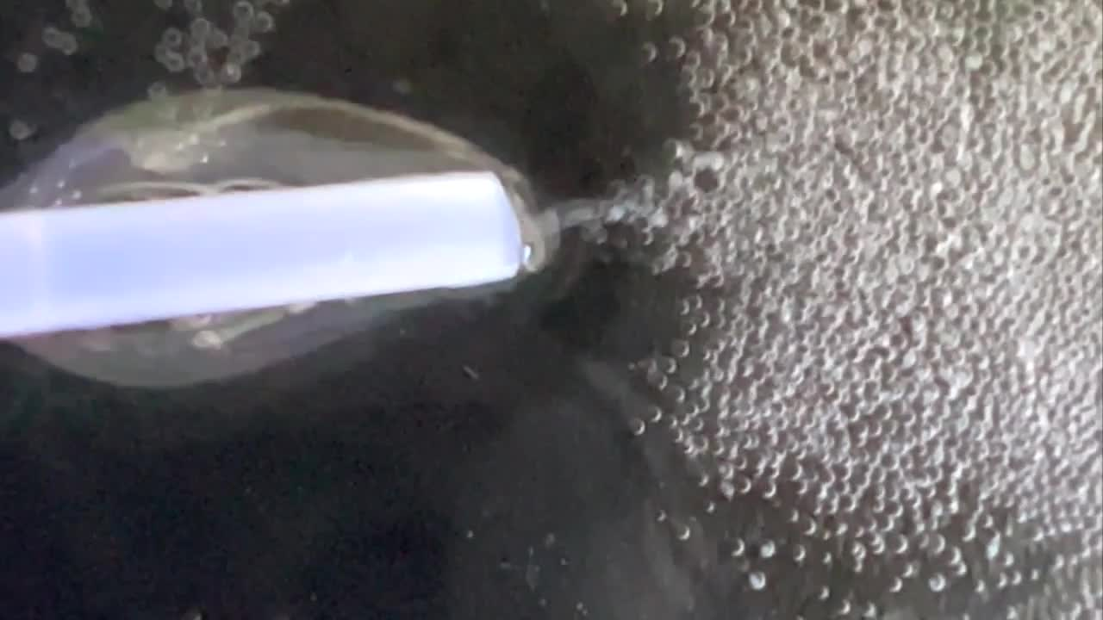
Monkey blastoids model early organization
A blastoid is a stem-cell-derived structure that resembles aspects of a blastocyst. It is not a cloned newborn monkey. The monkey study produced blastoids using several reprogrammed cell sources. These included nuclear-transfer embryonic stem cells derived from aged somatic donors. The preparation connected cellular reprogramming with an early embryo-like organization.
Embryonic stem cells can generate multiple cell types under suitable conditions. Their organization in culture differs from development within an intact pregnancy. The study also enclosed blastoids within hydrogel-based capsules. A hydrogel is a water-rich polymer network. The capsules provided a controlled three-dimensional environment for forming and maintaining the structures.
The original recording follows development of the cultured structures. Their formation tests a particular capacity for cellular self-organization. It does not reproduce every stage of whole-animal development. The distinction follows directly from the preparation. Nuclear reprogramming, embryo-like organization and live birth are separate experimental outcomes that require different evidence.
Wu et al. (2025), Fig. 2. Cultured monkey blastoids and lineage-marker assessment.
Wu (2025), Supplementary Movie 1. Cultured blastoid-capsule preparation.
Wu et al. (2025)
34
Notes:
• A **blastoid** is a stem-cell-derived structure that resembles aspects of a blastocyst. It is not a cloned newborn monkey. The monkey study produced blastoids using several reprogrammed cell sources. These included nuclear-transfer embryonic stem cells derived from aged somatic donors. The preparation connected cellular reprogramming with an early embryo-like organization.
• **Embryonic stem cells** can generate multiple cell types under suitable conditions. Their organization in culture differs from development within an intact pregnancy. The study also enclosed blastoids within hydrogel-based capsules. A **hydrogel** is a water-rich polymer network. The capsules provided a controlled three-dimensional environment for forming and maintaining the structures.
• The original recording follows development of the cultured structures. Their formation tests a particular capacity for cellular self-organization. It does not reproduce every stage of whole-animal development. The distinction follows directly from the preparation. Nuclear reprogramming, embryo-like organization and live birth are separate experimental outcomes that require different evidence.
References:
Wu J, Shao T, Tang Z, Liu G, Li Z, Shi Y, Kang Y, Zuo J, Zhao B, Hu G, Liu J, Ji W, Zhang L, Niu Y (2025). Highly efficient construction of monkey blastoid capsules from aged somatic cells. Nature communications 16(1):1130. https://doi.org/10.1038/s41467-025-56447-z
Figure: Wu et al. (2025), Fig. 2. Cultured monkey blastoids and lineage-marker assessment.
Figure source: https://doi.org/10.1038/s41467-025-56447-z
Embedded video: Wu (2025), Supplementary Movie 1. Cultured blastoid-capsule preparation.
Article: Wu J, Shao T, Tang Z, Liu G, Li Z, Shi Y, Kang Y, Zuo J, Zhao B, Hu G, Liu J, Ji W, Zhang L, Niu Y. (2025). Highly efficient construction of monkey blastoid capsules from aged somatic cells. Nature communications 16:1130. https://doi.org/10.1038/s41467-025-56447-z
Exact source filename: 41467_2025_56447_MOESM3_ESM.mp4
Original media/source page: https://www.ebi.ac.uk/europepmc/webservices/rest/PMC11775175/supplementaryFiles
Original source hash: 3f2d90748f05c57a6148b6afbea1f9432721ab900c609a0b5bee7fdb47c1c4fb
Embedded clip hash: 827828acfb9568d93c4e07b34ea4abfaa7996ac4f3cc91bf5a4e5df816d53295
Source recording interval: 0.000–10.773 s. Original scientific frames, proportions, author-provided timing and available audio retained. Playback seconds are not necessarily biological elapsed time in source time-lapse/accelerated films.
License: Open Access This article is licensed under a Creative Commons Attribution 4.0 International License, which permits use, sharing, adaptation, distribution and reproduction in any medium or format, as long as you give appropriate credit to the original author(s) and the source, provide a link to the Creative Commons licence, and indicate if changes were made. The images or other third party material in this article are included in the article’s Creative Commons licence, unless indicated otherwise in a credit line to the material. If material is not included in the article’s Creative Commons licence and your intended use is not permitted by statutory regulation or exceeds the permitted use, you will need to obtain permission directly from the copyright holder. To view a copy of this licence, visit http://creativecommons.org/licenses/by/4.0/ .
Native PPTX movie object with a separate static poster fallback. Desktop PowerPoint GUI playback and Google Slides import have not been tested. Google Slides may require inserting the supplied MP4 from Drive after import.

Slide 35
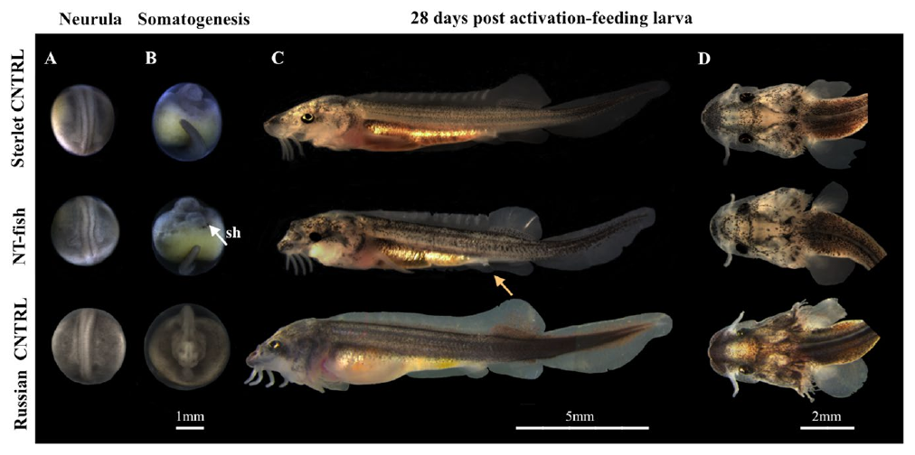

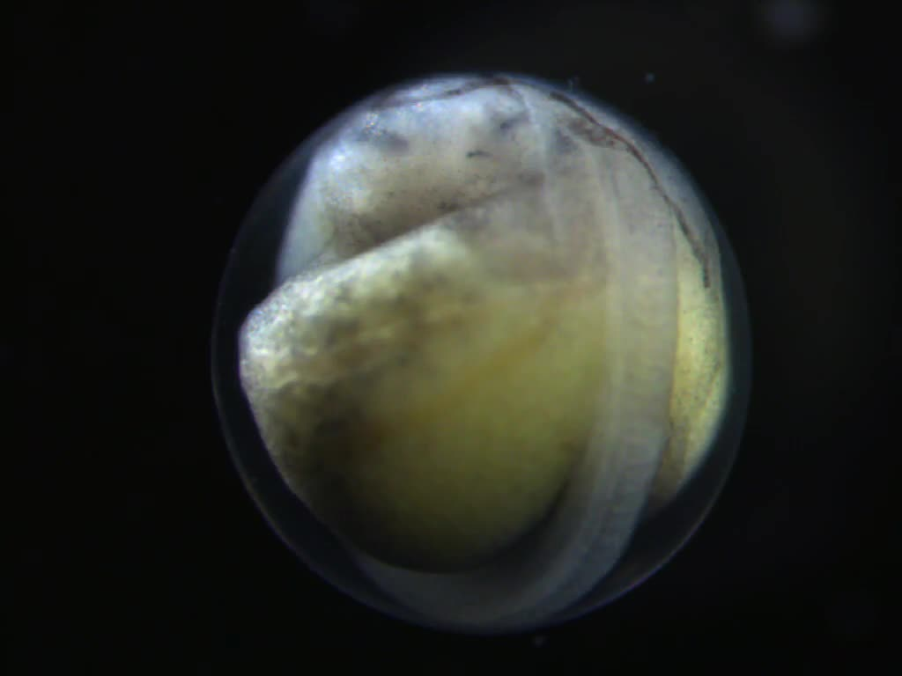
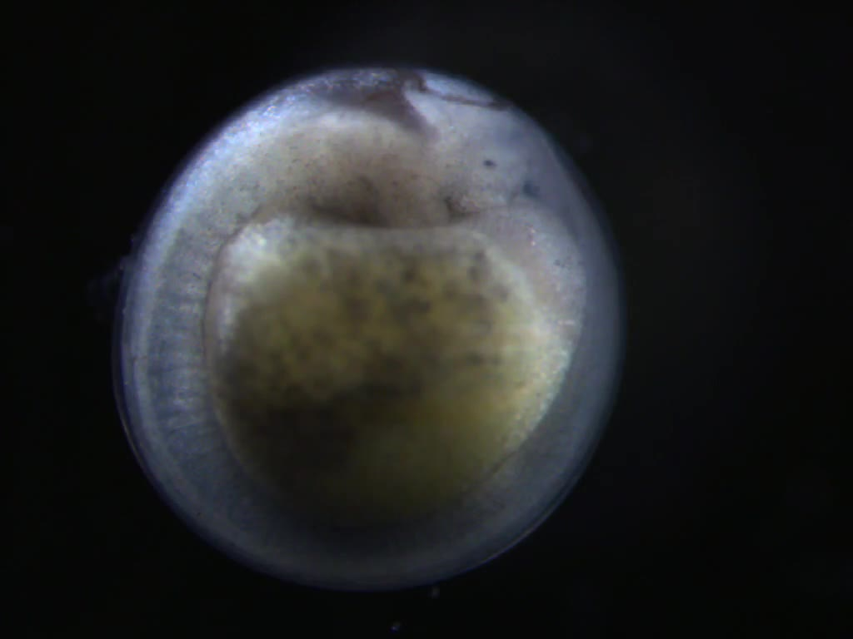
Sturgeon injection does not establish identity
Sturgeon nuclear-transfer experiments combined donor cells with recipient eggs from another species. They tested an interspecies approach relevant to reproductive biology. The manipulated eggs were followed through development. Genetic testing was necessary to determine the origin of surviving material. An injection procedure alone could not identify which genome supported a later embryo.
The study obtained a surviving outcome with maternal genomic origin. Gynogenesis is development in which the nuclear genome derives from the female contribution. That result differed from the intended donor-derived somatic clone. The distinction depended on genetic analysis. An animal’s development after manipulation was therefore not sufficient evidence of successful donor nuclear replacement.
A recipient egg carries its own biological history. Its genome and cytoplasm can contribute to unexpected outcomes after manipulation. Following development identifies what formed. Testing genetic origin identifies which nuclear contribution supported it. The combination connects the experimental procedure with the actual biological product rather than its intended label. At five days, the recorded larva had a visibly beating, swollen heart.
Fatira et al. (2018), Fig. 3. Control and manipulated sturgeon development; the surviving manipulated larva was maternally derived.
Photo: Acipenser ruthenus. no rights reserved. CC0 1.0.
Fatira (2018), Video S1. Five-day larva, frontal heart view.
Fatira (2018), Video S2. Five-day larva, lateral heart view.
Fatira et al. (2018)
35
Notes:
• Sturgeon nuclear-transfer experiments combined donor cells with recipient eggs from another species. They tested an interspecies approach relevant to reproductive biology. The manipulated eggs were followed through development. Genetic testing was necessary to determine the origin of surviving material. An injection procedure alone could not identify which genome supported a later embryo.
• The study obtained a surviving outcome with maternal genomic origin. **Gynogenesis** is development in which the nuclear genome derives from the female contribution. That result differed from the intended donor-derived somatic clone. The distinction depended on genetic analysis. An animal’s development after manipulation was therefore not sufficient evidence of successful donor nuclear replacement.
• A recipient egg carries its own biological history. Its genome and cytoplasm can contribute to unexpected outcomes after manipulation. Following development identifies what formed. Testing genetic origin identifies which nuclear contribution supported it. The combination connects the experimental procedure with the actual biological product rather than its intended label. At five days, the recorded larva had a visibly beating, swollen heart.
References:
Fatira E, Havelka M, Labbé C, Depincé A, Iegorova V, Pšenička M, Saito T (2018). Application of interspecific Somatic Cell Nuclear Transfer (iSCNT) in sturgeons and an unexpectedly produced gynogenetic sterlet with homozygous quadruple haploid. Scientific reports 8(1):5997. https://doi.org/10.1038/s41598-018-24376-1
Figure: Fatira et al. (2018), Fig. 3. Control and manipulated sturgeon development; the surviving manipulated larva was maternally derived.
Figure source: https://doi.org/10.1038/s41598-018-24376-1
Image: Photo: Acipenser ruthenus. Credit: no rights reserved. License: CC0 1.0. Source: https://www.inaturalist.org/observations/388484175
Embedded video: Fatira (2018), Video S1. Five-day larva, frontal heart view.
Article: Fatira E, Havelka M, Labbé C, Depincé A, Iegorova V, Pšenička M, Saito T. (2018). Application of interspecific Somatic Cell Nuclear Transfer (iSCNT) in sturgeons and an unexpectedly produced gynogenetic sterlet with homozygous quadruple haploid. Scientific reports 8:5997. https://doi.org/10.1038/s41598-018-24376-1
Exact source filename: 41598_2018_24376_MOESM2_ESM.mov
Original media/source page: https://www.ebi.ac.uk/europepmc/webservices/rest/PMC5902484/supplementaryFiles
Original source hash: 2984f3f8165147a1e37033c0405eb4599d1bd67545749df6219b79fe45f1f900
Embedded clip hash: cbe674e0363f533119921d82508e0747729986cba13385537ab72d77c83fbe63
Source recording interval: 0.000–27.330 s. Original scientific frames, proportions, author-provided timing and available audio retained. Playback seconds are not necessarily biological elapsed time in source time-lapse/accelerated films.
License: Open Access This article is licensed under a Creative Commons Attribution 4.0 International License, which permits use, sharing, adaptation, distribution and reproduction in any medium or format, as long as you give appropriate credit to the original author(s) and the source, provide a link to the Creative Commons license, and indicate if changes were made. The images or other third party material in this article are included in the article’s Creative Commons license, unless indicated otherwise in a credit line to the material. If material is not included in the article’s Creative Commons license and your intended use is not permitted by statutory regulation or exceeds the permitted use, you will need to obtain permission directly from the copyright holder. To view a copy of this license, visit http://creativecommons.org/licenses/by/4.0/ .
Native PPTX movie object with a separate static poster fallback. Desktop PowerPoint GUI playback and Google Slides import have not been tested. Google Slides may require inserting the supplied MP4 from Drive after import.
Embedded video: Fatira (2018), Video S2. Five-day larva, lateral heart view.
Article: Fatira E, Havelka M, Labbé C, Depincé A, Iegorova V, Pšenička M, Saito T. (2018). Application of interspecific Somatic Cell Nuclear Transfer (iSCNT) in sturgeons and an unexpectedly produced gynogenetic sterlet with homozygous quadruple haploid. Scientific reports 8:5997. https://doi.org/10.1038/s41598-018-24376-1
Exact source filename: 41598_2018_24376_MOESM3_ESM.mov
Original media/source page: https://www.ebi.ac.uk/europepmc/webservices/rest/PMC5902484/supplementaryFiles
Original source hash: 3bc9e97f97743f374c72a10d66c69fd331fa2aa8c608b2336417d6ed3438ffaa
Embedded clip hash: c901f0e061e59b878b7519b9510b2e98eb4655ff4ab9cce3057e6df80843a62a
Source recording interval: 0.000–6.890 s. Original scientific frames, proportions, author-provided timing and available audio retained. Playback seconds are not necessarily biological elapsed time in source time-lapse/accelerated films.
License: Open Access This article is licensed under a Creative Commons Attribution 4.0 International License, which permits use, sharing, adaptation, distribution and reproduction in any medium or format, as long as you give appropriate credit to the original author(s) and the source, provide a link to the Creative Commons license, and indicate if changes were made. The images or other third party material in this article are included in the article’s Creative Commons license, unless indicated otherwise in a credit line to the material. If material is not included in the article’s Creative Commons license and your intended use is not permitted by statutory regulation or exceeds the permitted use, you will need to obtain permission directly from the copyright holder. To view a copy of this license, visit http://creativecommons.org/licenses/by/4.0/ .
Native PPTX movie object with a separate static poster fallback. Desktop PowerPoint GUI playback and Google Slides import have not been tested. Google Slides may require inserting the supplied MP4 from Drive after import.

Slide 36
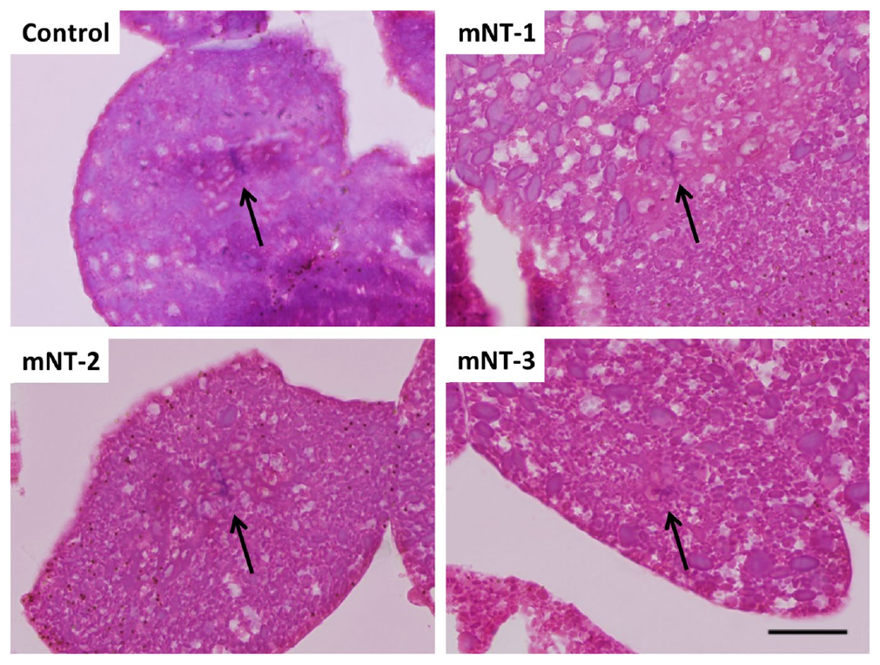
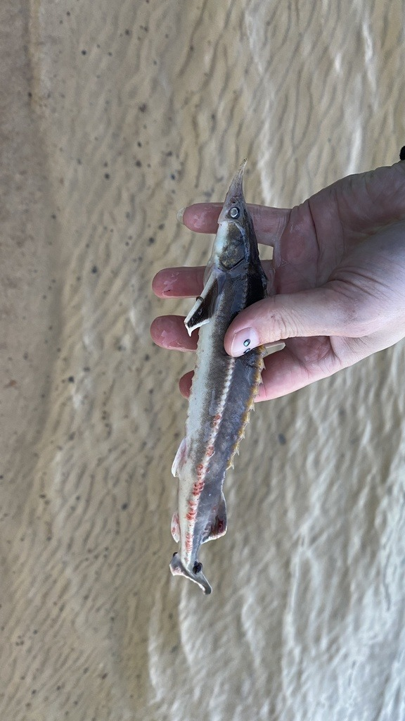
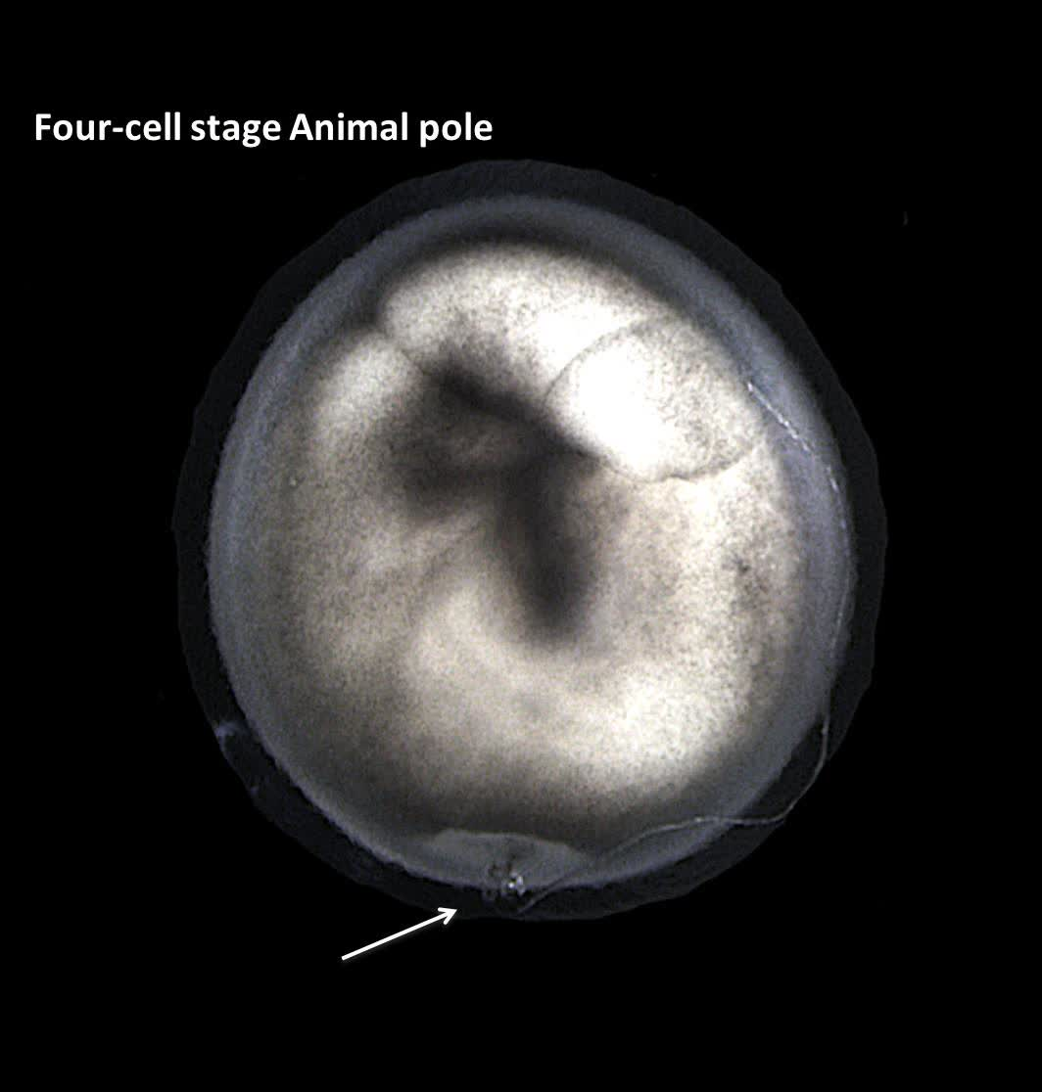
Sturgeon histology assesses tissue formation
A sturgeon embryo must progress beyond repeated cell division to form organized tissues. The later sturgeon study examined development after interspecies nuclear-transfer procedures. It included histological comparisons with control embryos. Histology examines the microscopic organization of tissues. Sectioning exposed internal features that could not be assessed from the egg’s surface alone.
Early cleavage creates a population of embryonic cells. Subsequent development changes their arrangement and specialization. Histological sections distinguish these internal developmental states. Comparisons with controls relate a manipulated embryo to ordinary embryogenesis. The method therefore assesses tissue organization rather than treating every cleaving egg as equivalent. Microinjection injury remained visible as the recorded embryo progressed through early development.
An embryo’s appearance, internal structure and genetic identity answer different questions. Visible development concerns the progression of form. Histology concerns the organization of cells and tissues. Genetic testing concerns the origin of the nuclear material. Sturgeon experiments combine these measurements to characterize what a nuclear-transfer procedure actually produces.
Fatira et al. (2019), Fig. 2. Histological sections of control and manipulated sturgeon embryos.
Photo: Acipenser ruthenus. Павлик Лисицын. CC BY 4.0.
Fatira (2019), Supplementary Movie 1. Injured reconstructed embryo development.
Fatira et al. (2019)
36
Notes:
• A sturgeon embryo must progress beyond repeated cell division to form organized tissues. The later sturgeon study examined development after interspecies nuclear-transfer procedures. It included histological comparisons with control embryos. **Histology** examines the microscopic organization of tissues. Sectioning exposed internal features that could not be assessed from the egg’s surface alone.
• Early cleavage creates a population of embryonic cells. Subsequent development changes their arrangement and specialization. Histological sections distinguish these internal developmental states. Comparisons with controls relate a manipulated embryo to ordinary embryogenesis. The method therefore assesses tissue organization rather than treating every cleaving egg as equivalent. Microinjection injury remained visible as the recorded embryo progressed through early development.
• An embryo’s appearance, internal structure and genetic identity answer different questions. Visible development concerns the progression of form. Histology concerns the organization of cells and tissues. Genetic testing concerns the origin of the nuclear material. Sturgeon experiments combine these measurements to characterize what a nuclear-transfer procedure actually produces.
References:
Fatira E, Havelka M, Labbé C, Depincé A, Pšenička M, Saito T (2019). A newly developed cloning technique in sturgeons; an important step towards recovering endangered species. Scientific reports 9(1):10453. https://doi.org/10.1038/s41598-019-46892-4
Figure: Fatira et al. (2019), Fig. 2. Histological sections of control and manipulated sturgeon embryos.
Figure source: https://doi.org/10.1038/s41598-019-46892-4
Image: Photo: Acipenser ruthenus. Credit: (c) Павлик Лисицын, some rights reserved (CC BY). License: CC BY 4.0. Source: https://www.inaturalist.org/observations/120762292
Embedded video: Fatira (2019), Supplementary Movie 1. Injured reconstructed embryo development.
Article: Fatira E, Havelka M, Labbé C, Depincé A, Pšenička M, Saito T. (2019). A newly developed cloning technique in sturgeons; an important step towards recovering endangered species. Scientific reports 9:10453. https://doi.org/10.1038/s41598-019-46892-4
Exact source filename: 41598_2019_46892_MOESM2_ESM.avi
Original media/source page: https://www.ebi.ac.uk/europepmc/webservices/rest/PMC6639416/supplementaryFiles
Original source hash: dcb1331a0d2656a0ae95feac3619fade0166e0c2e96d235a83257066de5c4a1a
Embedded clip hash: 0102dbcd93f7acf50817c4abf4634d00b1711bef3055c54996f0ec73bc8b16e7
Source recording interval: 0.000–12.000 s. Original scientific frames, proportions, author-provided timing and available audio retained. Playback seconds are not necessarily biological elapsed time in source time-lapse/accelerated films.
License: Open Access This article is licensed under a Creative Commons Attribution 4.0 International License, which permits use, sharing, adaptation, distribution and reproduction in any medium or format, as long as you give appropriate credit to the original author(s) and the source, provide a link to the Creative Commons license, and indicate if changes were made. The images or other third party material in this article are included in the article’s Creative Commons license, unless indicated otherwise in a credit line to the material. If material is not included in the article’s Creative Commons license and your intended use is not permitted by statutory regulation or exceeds the permitted use, you will need to obtain permission directly from the copyright holder. To view a copy of this license, visit http://creativecommons.org/licenses/by/4.0/ .
Native PPTX movie object with a separate static poster fallback. Desktop PowerPoint GUI playback and Google Slides import have not been tested. Google Slides may require inserting the supplied MP4 from Drive after import.

Slide 37

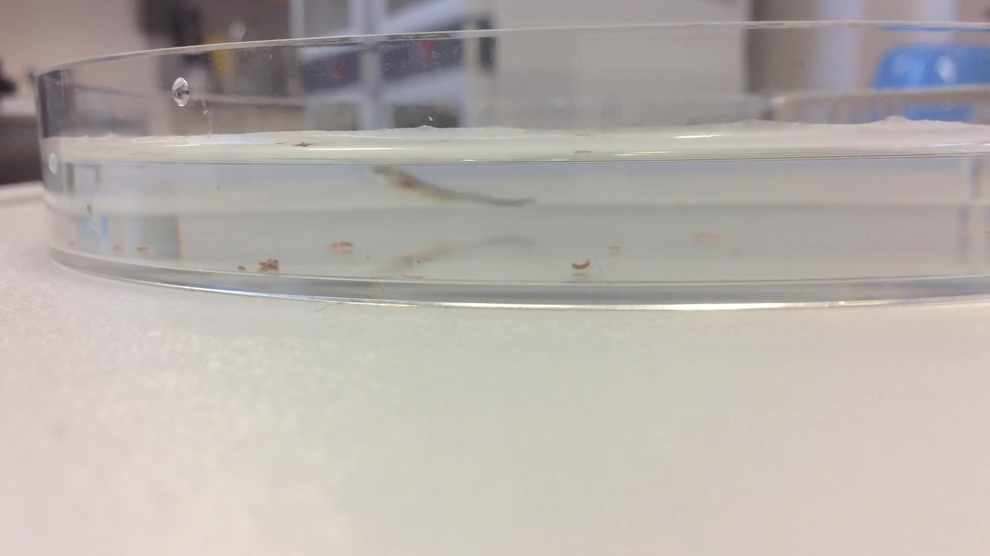
Genotyping identifies a maternal outcome
The sturgeon experiments produced a developmental outcome that differed from the intended nuclear clone. A surviving maternal-genome larva could still develop organized animal structures. Its development did not make it a donor-derived somatic clone. This difference changes the biological conclusion. Genetic origin must therefore accompany descriptions of developmental success. The original recording follows the larva feeding at 27 days after activation.
Ploidy describes the number of chromosome sets in a cell. A developmental outcome can differ in both genome origin and chromosome complement. The sturgeon study examined these properties experimentally. Their analysis distinguished the surviving larva from the expected donor-genome product. Nuclear transplantation can therefore create outcomes that require more precise descriptions than success or failure.
Conservation-oriented reproductive methods depend on which genome is preserved. A maternal-genome outcome preserves a different genetic contribution from the intended donor clone. Developmental monitoring alone would miss that distinction. Genetic characterization connects the resulting animal with the original reproductive goal. It makes identity part of the experimental outcome rather than an assumption about the procedure.
Fatira et al. (2018), Fig. 3. Control and manipulated sturgeon development; the surviving manipulated larva was maternally derived.
Photo: Acipenser ruthenus. Иван Пристрем. CC BY 4.0.
Fatira (2018), Video S3. Maternal-genome larva feeding at day 27.
Fatira et al. (2018)
37
Notes:
• The sturgeon experiments produced a developmental outcome that differed from the intended nuclear clone. A surviving maternal-genome larva could still develop organized animal structures. Its development did not make it a donor-derived somatic clone. This difference changes the biological conclusion. Genetic origin must therefore accompany descriptions of developmental success. The original recording follows the larva feeding at 27 days after activation.
• **Ploidy** describes the number of chromosome sets in a cell. A developmental outcome can differ in both genome origin and chromosome complement. The sturgeon study examined these properties experimentally. Their analysis distinguished the surviving larva from the expected donor-genome product. Nuclear transplantation can therefore create outcomes that require more precise descriptions than success or failure.
• Conservation-oriented reproductive methods depend on which genome is preserved. A maternal-genome outcome preserves a different genetic contribution from the intended donor clone. Developmental monitoring alone would miss that distinction. Genetic characterization connects the resulting animal with the original reproductive goal. It makes identity part of the experimental outcome rather than an assumption about the procedure.
References:
Fatira E, Havelka M, Labbé C, Depincé A, Iegorova V, Pšenička M, Saito T (2018). Application of interspecific Somatic Cell Nuclear Transfer (iSCNT) in sturgeons and an unexpectedly produced gynogenetic sterlet with homozygous quadruple haploid. Scientific reports 8(1):5997. https://doi.org/10.1038/s41598-018-24376-1
Figure: Fatira et al. (2018), Fig. 3. Control and manipulated sturgeon development; the surviving manipulated larva was maternally derived.
Figure source: https://doi.org/10.1038/s41598-018-24376-1
Image: Photo: Acipenser ruthenus. Credit: (c) Иван Пристрем, some rights reserved (CC BY). License: CC BY 4.0. Source: https://www.inaturalist.org/observations/115912425
Embedded video: Fatira (2018), Video S3. Maternal-genome larva feeding at day 27.
Article: Fatira E, Havelka M, Labbé C, Depincé A, Iegorova V, Pšenička M, Saito T. (2018). Application of interspecific Somatic Cell Nuclear Transfer (iSCNT) in sturgeons and an unexpectedly produced gynogenetic sterlet with homozygous quadruple haploid. Scientific reports 8:5997. https://doi.org/10.1038/s41598-018-24376-1
Exact source filename: 41598_2018_24376_MOESM4_ESM.mov
Original media/source page: https://www.ebi.ac.uk/europepmc/webservices/rest/PMC5902484/supplementaryFiles
Original source hash: f123b37a81b542c9629d4bbb453c19fbaf5e318ccad30edf86f1372f4c43b713
Embedded clip hash: e5864b78e8f8c841a11175cebdf5bae2993684b0531ad76e71d1d8d6867689dd
Source recording interval: 0.000–14.489 s. Original scientific frames, proportions, author-provided timing and available audio retained. Playback seconds are not necessarily biological elapsed time in source time-lapse/accelerated films.
License: Open Access This article is licensed under a Creative Commons Attribution 4.0 International License, which permits use, sharing, adaptation, distribution and reproduction in any medium or format, as long as you give appropriate credit to the original author(s) and the source, provide a link to the Creative Commons license, and indicate if changes were made. The images or other third party material in this article are included in the article’s Creative Commons license, unless indicated otherwise in a credit line to the material. If material is not included in the article’s Creative Commons license and your intended use is not permitted by statutory regulation or exceeds the permitted use, you will need to obtain permission directly from the copyright holder. To view a copy of this license, visit http://creativecommons.org/licenses/by/4.0/ .
Native PPTX movie object with a separate static poster fallback. Desktop PowerPoint GUI playback and Google Slides import have not been tested. Google Slides may require inserting the supplied MP4 from Drive after import.

Slide 38
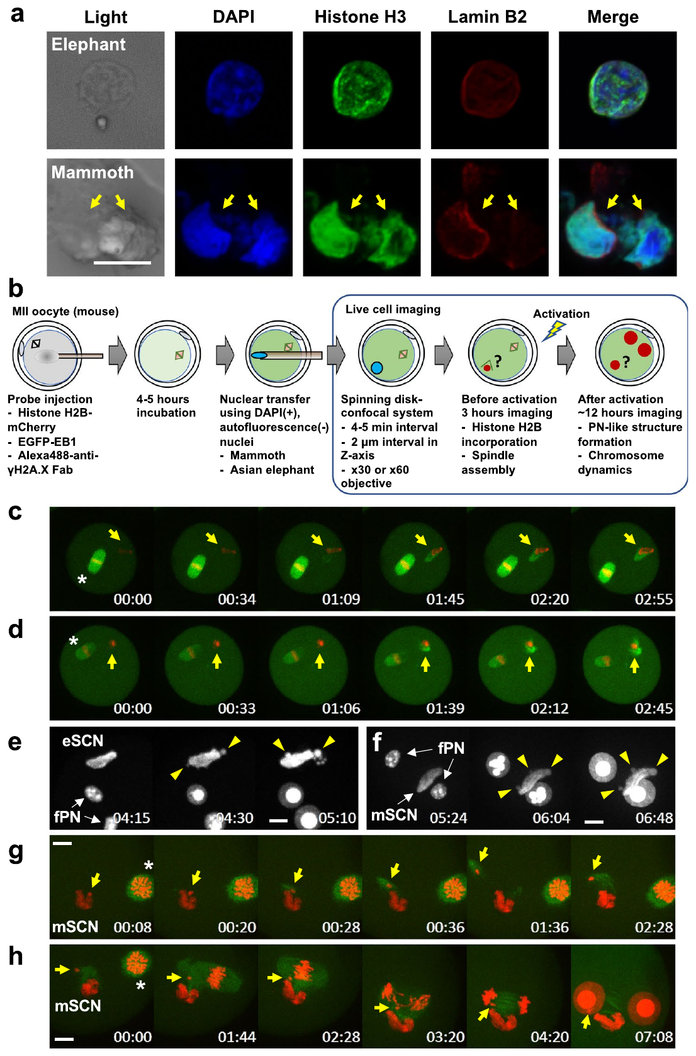
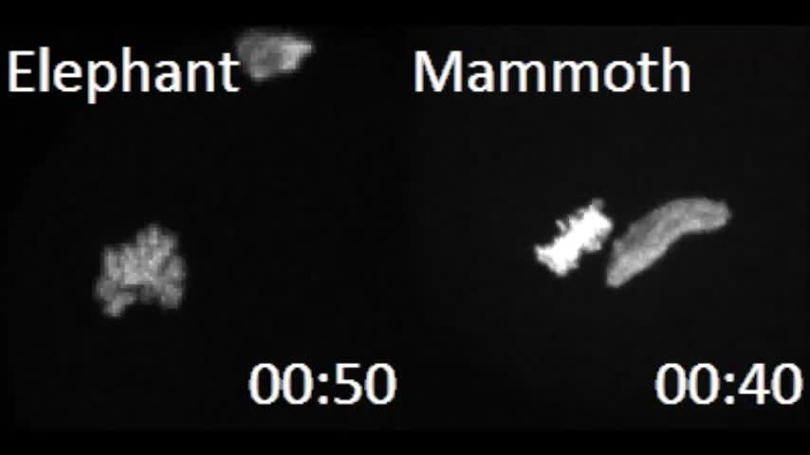
Ancient nuclei retain some components
The mammoth-nucleus study examined material from an approximately 28,000-year-old specimen. Investigators isolated nuclear material and introduced it into mouse oocytes. Elephant nuclear material provided a comparative preparation. The experiment tested molecular responses inside the recipient cell. It did not produce a cloned mammoth or a developing mammoth animal.
Ancient nuclear material can retain some components while suffering substantial damage. Detecting a component therefore differs from recovering an intact developmental genome. The study combined molecular analyses with live-cell imaging. This allowed particular responses to be observed after nuclear introduction. The outcome was a set of measured cellular activities rather than whole-animal development.
The recipient mouse oocyte supplied an active cellular environment. Its molecules could interact with introduced nuclear material. Those interactions revealed which processes still occurred in that preparation. Comparing elephant and mammoth material added a biologically relevant reference. The experiments connected preservation of ancient material with specific responses of a living recipient cell.
Yamagata et al. (2019), Fig. 3. Introduced elephant and mammoth nuclear material in mouse oocytes.
Yamagata (2019), 41598_2019_40546_MOESM3_ESM.mp4. Nuclear formation after activation.
Yamagata et al. (2019)
38
Notes:
• The mammoth-nucleus study examined material from an approximately 28,000-year-old specimen. Investigators isolated nuclear material and introduced it into mouse oocytes. Elephant nuclear material provided a comparative preparation. The experiment tested molecular responses inside the recipient cell. It did not produce a cloned mammoth or a developing mammoth animal.
• Ancient nuclear material can retain some components while suffering substantial damage. Detecting a component therefore differs from recovering an intact developmental genome. The study combined molecular analyses with live-cell imaging. This allowed particular responses to be observed after nuclear introduction. The outcome was a set of measured cellular activities rather than whole-animal development.
• The recipient mouse oocyte supplied an active cellular environment. Its molecules could interact with introduced nuclear material. Those interactions revealed which processes still occurred in that preparation. Comparing elephant and mammoth material added a biologically relevant reference. The experiments connected preservation of ancient material with specific responses of a living recipient cell.
References:
Yamagata K, Nagai K, Miyamoto H, Anzai M, Kato H, Miyamoto K, Kurosaka S, Azuma R, Kolodeznikov II, Protopopov AV, Plotnikov VV, Kobayashi H, Kawahara-Miki R, Kono T, Uchida M, Shibata Y, Handa T, Kimura H, Hosoi Y, Mitani T, Matsumoto K, Iritani A (2019). Signs of biological activities of 28,000-year-old mammoth nuclei in mouse oocytes visualized by live-cell imaging. Scientific reports 9(1):4050. https://doi.org/10.1038/s41598-019-40546-1
Figure: Yamagata et al. (2019), Fig. 3. Introduced elephant and mammoth nuclear material in mouse oocytes.
Figure source: https://doi.org/10.1038/s41598-019-40546-1
Embedded video: Yamagata (2019), 41598_2019_40546_MOESM3_ESM.mp4. Nuclear formation after activation.
Article: Yamagata K, Nagai K, Miyamoto H, Anzai M, Kato H, Miyamoto K, Kurosaka S, Azuma R, Kolodeznikov II, Protopopov AV, Plotnikov VV, Kobayashi H, Kawahara-Miki R, Kono T, Uchida M, Shibata Y, Handa T, Kimura H, Hosoi Y, Mitani T, Matsumoto K, Iritani A. (2019). Signs of biological activities of 28,000-year-old mammoth nuclei in mouse oocytes visualized by live-cell imaging. Scientific reports 9:4050. https://doi.org/10.1038/s41598-019-40546-1
Exact source filename: 41598_2019_40546_MOESM3_ESM.mp4
Original media/source page: https://www.ebi.ac.uk/europepmc/webservices/rest/PMC6411884/supplementaryFiles
Original source hash: f8a6c1e0979f1752745a30048d7b42b29b75bfc50a7b19441f2fa8b140468f05
Embedded clip hash: cf24b37d4daed66c746467fbb50bfa21775238c3e02963952d79438eb60387a9
Source recording interval: 0.000–11.011 s. Original scientific frames, proportions, author-provided timing and available audio retained. Playback seconds are not necessarily biological elapsed time in source time-lapse/accelerated films.
License: Open Access This article is licensed under a Creative Commons Attribution 4.0 International License, which permits use, sharing, adaptation, distribution and reproduction in any medium or format, as long as you give appropriate credit to the original author(s) and the source, provide a link to the Creative Commons license, and indicate if changes were made. The images or other third party material in this article are included in the article’s Creative Commons license, unless indicated otherwise in a credit line to the material. If material is not included in the article’s Creative Commons license and your intended use is not permitted by statutory regulation or exceeds the permitted use, you will need to obtain permission directly from the copyright holder. To view a copy of this license, visit http://creativecommons.org/licenses/by/4.0/ .
Native PPTX movie object with a separate static poster fallback. Desktop PowerPoint GUI playback and Google Slides import have not been tested. Google Slides may require inserting the supplied MP4 from Drive after import.

Slide 39

Histone recruitment tests chromatin responses
Histones are proteins that associate with DNA to form chromatin. The mammoth experiments used fluorescent histone H2B labeling during live imaging. This distinguished labeled chromatin-associated material from the surrounding oocyte. Recordings followed responses after introduction of elephant or mammoth nuclei. The source colors were part of the original experiment.
An oocyte can supply molecules that bind introduced nuclear material. Observing such binding tests one component of nuclear reorganization. It does not require the introduced material to complete embryonic development. The experiment therefore separated a molecular response from a later organismal outcome. This distinction defined what the observed activity represented.
The sequence of events matters in evaluating nuclear remodeling. An immediate response and a change after activation occur in different cellular states. The recordings preserved those temporal relationships. They allowed introduced material to be followed within the same recipient environment. Ancient chromatin could consequently be examined through its interactions with living cellular machinery.
Yamagata et al. (2019), Fig. 3. Introduced elephant and mammoth nuclear material in mouse oocytes.
Yamagata (2019), 41598_2019_40546_MOESM2_ESM.mp4. Elephant/mammoth chromatin response.
Yamagata et al. (2019)
39
Notes:
• **Histones** are proteins that associate with DNA to form chromatin. The mammoth experiments used fluorescent histone H2B labeling during live imaging. This distinguished labeled chromatin-associated material from the surrounding oocyte. Recordings followed responses after introduction of elephant or mammoth nuclei. The source colors were part of the original experiment.
• An oocyte can supply molecules that bind introduced nuclear material. Observing such binding tests one component of nuclear reorganization. It does not require the introduced material to complete embryonic development. The experiment therefore separated a molecular response from a later organismal outcome. This distinction defined what the observed activity represented.
• The sequence of events matters in evaluating nuclear remodeling. An immediate response and a change after activation occur in different cellular states. The recordings preserved those temporal relationships. They allowed introduced material to be followed within the same recipient environment. Ancient chromatin could consequently be examined through its interactions with living cellular machinery.
References:
Yamagata K, Nagai K, Miyamoto H, Anzai M, Kato H, Miyamoto K, Kurosaka S, Azuma R, Kolodeznikov II, Protopopov AV, Plotnikov VV, Kobayashi H, Kawahara-Miki R, Kono T, Uchida M, Shibata Y, Handa T, Kimura H, Hosoi Y, Mitani T, Matsumoto K, Iritani A (2019). Signs of biological activities of 28,000-year-old mammoth nuclei in mouse oocytes visualized by live-cell imaging. Scientific reports 9(1):4050. https://doi.org/10.1038/s41598-019-40546-1
Figure: Yamagata et al. (2019), Fig. 3. Introduced elephant and mammoth nuclear material in mouse oocytes.
Figure source: https://doi.org/10.1038/s41598-019-40546-1
Embedded video: Yamagata (2019), 41598_2019_40546_MOESM2_ESM.mp4. Elephant/mammoth chromatin response.
Article: Yamagata K, Nagai K, Miyamoto H, Anzai M, Kato H, Miyamoto K, Kurosaka S, Azuma R, Kolodeznikov II, Protopopov AV, Plotnikov VV, Kobayashi H, Kawahara-Miki R, Kono T, Uchida M, Shibata Y, Handa T, Kimura H, Hosoi Y, Mitani T, Matsumoto K, Iritani A. (2019). Signs of biological activities of 28,000-year-old mammoth nuclei in mouse oocytes visualized by live-cell imaging. Scientific reports 9:4050. https://doi.org/10.1038/s41598-019-40546-1
Exact source filename: 41598_2019_40546_MOESM2_ESM.mp4
Original media/source page: https://www.ebi.ac.uk/europepmc/webservices/rest/PMC6411884/supplementaryFiles
Original source hash: dc6afaf84cae9f0451f12a73ef1bc6b85ec1fb28a4fea9e36c8cc68a743016f0
Embedded clip hash: 27aea2bfbbf420c6fe611b3788d70c8f8bd6729f4313f4a25a61176d216f8921
Source recording interval: 0.000–6.006 s. Original scientific frames, proportions, author-provided timing and available audio retained. Playback seconds are not necessarily biological elapsed time in source time-lapse/accelerated films.
License: Open Access This article is licensed under a Creative Commons Attribution 4.0 International License, which permits use, sharing, adaptation, distribution and reproduction in any medium or format, as long as you give appropriate credit to the original author(s) and the source, provide a link to the Creative Commons license, and indicate if changes were made. The images or other third party material in this article are included in the article’s Creative Commons license, unless indicated otherwise in a credit line to the material. If material is not included in the article’s Creative Commons license and your intended use is not permitted by statutory regulation or exceeds the permitted use, you will need to obtain permission directly from the copyright holder. To view a copy of this license, visit http://creativecommons.org/licenses/by/4.0/ .
Native PPTX movie object with a separate static poster fallback. Desktop PowerPoint GUI playback and Google Slides import have not been tested. Google Slides may require inserting the supplied MP4 from Drive after import.

Slide 40


Spindle responses concern chromosome handling
The spindle is a microtubule-based structure involved in chromosome organization and segregation. The mammoth study labeled a spindle-associated protein during live imaging. The original recordings distinguish this signal from the chromatin label. They follow responses after nuclear introduction and oocyte activation. These events concern the recipient cell’s handling of introduced nuclear material.
Microtubules are dynamic protein polymers that contribute to spindle structure. Their organization changes during the cell cycle. An introduced nucleus therefore encounters a regulated, changing cytoplasmic environment. A response before activation can differ from one after activation. Time-resolved imaging preserves this relationship between cellular state and observed organization.
A spindle-associated response is one requirement among many for development. Chromosomes must also contain an appropriately organized and functional genome. The ancient-nucleus experiments examined individual cellular responses without producing an animal. Their value lies in identifying those responses precisely. Nuclear activity and complete developmental competence are different levels of biological outcome.
Yamagata et al. (2019), Fig. 3. Introduced elephant and mammoth nuclear material in mouse oocytes.
Yamagata (2019), 41598_2019_40546_MOESM4_ESM.mp4. Mammoth chromosome/spindle response.
Yamagata (2019), 41598_2019_40546_MOESM5_ESM.mp4. Chromosome/spindle response after activation.
Yamagata et al. (2019)
40
Notes:
• The **spindle** is a microtubule-based structure involved in chromosome organization and segregation. The mammoth study labeled a spindle-associated protein during live imaging. The original recordings distinguish this signal from the chromatin label. They follow responses after nuclear introduction and oocyte activation. These events concern the recipient cell’s handling of introduced nuclear material.
• **Microtubules** are dynamic protein polymers that contribute to spindle structure. Their organization changes during the cell cycle. An introduced nucleus therefore encounters a regulated, changing cytoplasmic environment. A response before activation can differ from one after activation. Time-resolved imaging preserves this relationship between cellular state and observed organization.
• A spindle-associated response is one requirement among many for development. Chromosomes must also contain an appropriately organized and functional genome. The ancient-nucleus experiments examined individual cellular responses without producing an animal. Their value lies in identifying those responses precisely. Nuclear activity and complete developmental competence are different levels of biological outcome.
References:
Yamagata K, Nagai K, Miyamoto H, Anzai M, Kato H, Miyamoto K, Kurosaka S, Azuma R, Kolodeznikov II, Protopopov AV, Plotnikov VV, Kobayashi H, Kawahara-Miki R, Kono T, Uchida M, Shibata Y, Handa T, Kimura H, Hosoi Y, Mitani T, Matsumoto K, Iritani A (2019). Signs of biological activities of 28,000-year-old mammoth nuclei in mouse oocytes visualized by live-cell imaging. Scientific reports 9(1):4050. https://doi.org/10.1038/s41598-019-40546-1
Figure: Yamagata et al. (2019), Fig. 3. Introduced elephant and mammoth nuclear material in mouse oocytes.
Figure source: https://doi.org/10.1038/s41598-019-40546-1
Embedded video: Yamagata (2019), 41598_2019_40546_MOESM4_ESM.mp4. Mammoth chromosome/spindle response.
Article: Yamagata K, Nagai K, Miyamoto H, Anzai M, Kato H, Miyamoto K, Kurosaka S, Azuma R, Kolodeznikov II, Protopopov AV, Plotnikov VV, Kobayashi H, Kawahara-Miki R, Kono T, Uchida M, Shibata Y, Handa T, Kimura H, Hosoi Y, Mitani T, Matsumoto K, Iritani A. (2019). Signs of biological activities of 28,000-year-old mammoth nuclei in mouse oocytes visualized by live-cell imaging. Scientific reports 9:4050. https://doi.org/10.1038/s41598-019-40546-1
Exact source filename: 41598_2019_40546_MOESM4_ESM.mp4
Original media/source page: https://www.ebi.ac.uk/europepmc/webservices/rest/PMC6411884/supplementaryFiles
Original source hash: 6d43d0a5c83ba2136f6431ee197475d3dd49e52ccc35bbd2e7ef40b31560c3eb
Embedded clip hash: 3326e7093102a9ac7114447b0523983d6da1e79b891e94985b9b901687c3918e
Source recording interval: 0.000–4.004 s. Original scientific frames, proportions, author-provided timing and available audio retained. Playback seconds are not necessarily biological elapsed time in source time-lapse/accelerated films.
License: Open Access This article is licensed under a Creative Commons Attribution 4.0 International License, which permits use, sharing, adaptation, distribution and reproduction in any medium or format, as long as you give appropriate credit to the original author(s) and the source, provide a link to the Creative Commons license, and indicate if changes were made. The images or other third party material in this article are included in the article’s Creative Commons license, unless indicated otherwise in a credit line to the material. If material is not included in the article’s Creative Commons license and your intended use is not permitted by statutory regulation or exceeds the permitted use, you will need to obtain permission directly from the copyright holder. To view a copy of this license, visit http://creativecommons.org/licenses/by/4.0/ .
Native PPTX movie object with a separate static poster fallback. Desktop PowerPoint GUI playback and Google Slides import have not been tested. Google Slides may require inserting the supplied MP4 from Drive after import.
Embedded video: Yamagata (2019), 41598_2019_40546_MOESM5_ESM.mp4. Chromosome/spindle response after activation.
Article: Yamagata K, Nagai K, Miyamoto H, Anzai M, Kato H, Miyamoto K, Kurosaka S, Azuma R, Kolodeznikov II, Protopopov AV, Plotnikov VV, Kobayashi H, Kawahara-Miki R, Kono T, Uchida M, Shibata Y, Handa T, Kimura H, Hosoi Y, Mitani T, Matsumoto K, Iritani A. (2019). Signs of biological activities of 28,000-year-old mammoth nuclei in mouse oocytes visualized by live-cell imaging. Scientific reports 9:4050. https://doi.org/10.1038/s41598-019-40546-1
Exact source filename: 41598_2019_40546_MOESM5_ESM.mp4
Original media/source page: https://www.ebi.ac.uk/europepmc/webservices/rest/PMC6411884/supplementaryFiles
Original source hash: a04bc8961926d023da106451ddacefcccb0096441485d19ceee404e87972fb01
Embedded clip hash: ee7cf38547a35dcbcd66078b6c4798a91c273a66e9e55eafbf2d7d2a5c3a97be
Source recording interval: 0.000–17.017 s. Original scientific frames, proportions, author-provided timing and available audio retained. Playback seconds are not necessarily biological elapsed time in source time-lapse/accelerated films.
License: Open Access This article is licensed under a Creative Commons Attribution 4.0 International License, which permits use, sharing, adaptation, distribution and reproduction in any medium or format, as long as you give appropriate credit to the original author(s) and the source, provide a link to the Creative Commons license, and indicate if changes were made. The images or other third party material in this article are included in the article’s Creative Commons license, unless indicated otherwise in a credit line to the material. If material is not included in the article’s Creative Commons license and your intended use is not permitted by statutory regulation or exceeds the permitted use, you will need to obtain permission directly from the copyright holder. To view a copy of this license, visit http://creativecommons.org/licenses/by/4.0/ .
Native PPTX movie object with a separate static poster fallback. Desktop PowerPoint GUI playback and Google Slides import have not been tested. Google Slides may require inserting the supplied MP4 from Drive after import.

Slide 41


DNA damage responses follow nuclear transfer
A DNA double-strand break disrupts both strands of the DNA molecule. Ancient nuclear material can contain extensive damage. The mammoth study followed damage-associated signals after introducing nuclear material into mouse oocytes. Separate recordings examined the period after introduction and after activation. The response could therefore be related to the recipient cell’s state.
A damage-associated signal reports a molecular process rather than a completed repair outcome. Its distribution can change over time. Live imaging follows that changing distribution within the recipient. Comparing stages separates immediate recognition from later responses. The preparation consequently permits a temporal analysis of damaged nuclear material in a living cellular environment.
A genome capable of sustaining development requires much more than detectable molecular activity. Its chromosomes must support coordinated replication and gene expression. The mammoth experiments stopped short of whole-animal development. Their recordings nevertheless preserved specific interactions with recipient-cell machinery. These outcomes define the measured biology without turning cellular activity into a claim of resurrection.
Yamagata et al. (2019), Fig. 3. Introduced elephant and mammoth nuclear material in mouse oocytes.
Yamagata (2019), 41598_2019_40546_MOESM6_ESM.mp4. DNA-damage response after injection.
Yamagata (2019), 41598_2019_40546_MOESM7_ESM.mp4. DNA-damage response after activation.
Yamagata et al. (2019)
41
Notes:
• A **DNA double-strand break** disrupts both strands of the DNA molecule. Ancient nuclear material can contain extensive damage. The mammoth study followed damage-associated signals after introducing nuclear material into mouse oocytes. Separate recordings examined the period after introduction and after activation. The response could therefore be related to the recipient cell’s state.
• A damage-associated signal reports a molecular process rather than a completed repair outcome. Its distribution can change over time. Live imaging follows that changing distribution within the recipient. Comparing stages separates immediate recognition from later responses. The preparation consequently permits a temporal analysis of damaged nuclear material in a living cellular environment.
• A genome capable of sustaining development requires much more than detectable molecular activity. Its chromosomes must support coordinated replication and gene expression. The mammoth experiments stopped short of whole-animal development. Their recordings nevertheless preserved specific interactions with recipient-cell machinery. These outcomes define the measured biology without turning cellular activity into a claim of resurrection.
References:
Yamagata K, Nagai K, Miyamoto H, Anzai M, Kato H, Miyamoto K, Kurosaka S, Azuma R, Kolodeznikov II, Protopopov AV, Plotnikov VV, Kobayashi H, Kawahara-Miki R, Kono T, Uchida M, Shibata Y, Handa T, Kimura H, Hosoi Y, Mitani T, Matsumoto K, Iritani A (2019). Signs of biological activities of 28,000-year-old mammoth nuclei in mouse oocytes visualized by live-cell imaging. Scientific reports 9(1):4050. https://doi.org/10.1038/s41598-019-40546-1
Figure: Yamagata et al. (2019), Fig. 3. Introduced elephant and mammoth nuclear material in mouse oocytes.
Figure source: https://doi.org/10.1038/s41598-019-40546-1
Embedded video: Yamagata (2019), 41598_2019_40546_MOESM6_ESM.mp4. DNA-damage response after injection.
Article: Yamagata K, Nagai K, Miyamoto H, Anzai M, Kato H, Miyamoto K, Kurosaka S, Azuma R, Kolodeznikov II, Protopopov AV, Plotnikov VV, Kobayashi H, Kawahara-Miki R, Kono T, Uchida M, Shibata Y, Handa T, Kimura H, Hosoi Y, Mitani T, Matsumoto K, Iritani A. (2019). Signs of biological activities of 28,000-year-old mammoth nuclei in mouse oocytes visualized by live-cell imaging. Scientific reports 9:4050. https://doi.org/10.1038/s41598-019-40546-1
Exact source filename: 41598_2019_40546_MOESM6_ESM.mp4
Original media/source page: https://www.ebi.ac.uk/europepmc/webservices/rest/PMC6411884/supplementaryFiles
Original source hash: 3f0ba979dce06cf371a509cd38de508f889694616ca26c5daa428687c8561d27
Embedded clip hash: 36ee1f9db21ed0297c10ef5e4713a58b91ead232b3e1efecb21e3c768ff0bd43
Source recording interval: 0.000–3.003 s. Original scientific frames, proportions, author-provided timing and available audio retained. Playback seconds are not necessarily biological elapsed time in source time-lapse/accelerated films.
License: Open Access This article is licensed under a Creative Commons Attribution 4.0 International License, which permits use, sharing, adaptation, distribution and reproduction in any medium or format, as long as you give appropriate credit to the original author(s) and the source, provide a link to the Creative Commons license, and indicate if changes were made. The images or other third party material in this article are included in the article’s Creative Commons license, unless indicated otherwise in a credit line to the material. If material is not included in the article’s Creative Commons license and your intended use is not permitted by statutory regulation or exceeds the permitted use, you will need to obtain permission directly from the copyright holder. To view a copy of this license, visit http://creativecommons.org/licenses/by/4.0/ .
Native PPTX movie object with a separate static poster fallback. Desktop PowerPoint GUI playback and Google Slides import have not been tested. Google Slides may require inserting the supplied MP4 from Drive after import.
Embedded video: Yamagata (2019), 41598_2019_40546_MOESM7_ESM.mp4. DNA-damage response after activation.
Article: Yamagata K, Nagai K, Miyamoto H, Anzai M, Kato H, Miyamoto K, Kurosaka S, Azuma R, Kolodeznikov II, Protopopov AV, Plotnikov VV, Kobayashi H, Kawahara-Miki R, Kono T, Uchida M, Shibata Y, Handa T, Kimura H, Hosoi Y, Mitani T, Matsumoto K, Iritani A. (2019). Signs of biological activities of 28,000-year-old mammoth nuclei in mouse oocytes visualized by live-cell imaging. Scientific reports 9:4050. https://doi.org/10.1038/s41598-019-40546-1
Exact source filename: 41598_2019_40546_MOESM7_ESM.mp4
Original media/source page: https://www.ebi.ac.uk/europepmc/webservices/rest/PMC6411884/supplementaryFiles
Original source hash: 98a0a2f6a481ed8ae1d7327000a4d3b8d2b307866d326a63c3f077d12805da45
Embedded clip hash: abcb9fbafa0e927a1602cc8f9c4f7ff72ecc6c784eef075e28e34e024140afee
Source recording interval: 0.000–15.015 s. Original scientific frames, proportions, author-provided timing and available audio retained. Playback seconds are not necessarily biological elapsed time in source time-lapse/accelerated films.
License: Open Access This article is licensed under a Creative Commons Attribution 4.0 International License, which permits use, sharing, adaptation, distribution and reproduction in any medium or format, as long as you give appropriate credit to the original author(s) and the source, provide a link to the Creative Commons license, and indicate if changes were made. The images or other third party material in this article are included in the article’s Creative Commons license, unless indicated otherwise in a credit line to the material. If material is not included in the article’s Creative Commons license and your intended use is not permitted by statutory regulation or exceeds the permitted use, you will need to obtain permission directly from the copyright holder. To view a copy of this license, visit http://creativecommons.org/licenses/by/4.0/ .
Native PPTX movie object with a separate static poster fallback. Desktop PowerPoint GUI playback and Google Slides import have not been tested. Google Slides may require inserting the supplied MP4 from Drive after import.

Slide 42


Mouse oocytes can reduce somatic ploidy
Ordinary somatic cells are diploid, whereas gametes carry one chromosome set. The mouse study replaced the meiotic spindle of a mature oocyte with a somatic nucleus. The recipient assembled a new spindle from the introduced chromosomes. Fertilization then triggered chromosome segregation. One chromosome complement could be extruded into a pseudo-polar body.
A pseudo-polar body is an experimentally produced structure resembling the polar body of normal meiosis. Its formation removed a contribution from the introduced somatic genome. The remaining somatic contribution could combine with a sperm contribution. The resulting preparation therefore differed from standard reproductive SCNT. It joined somatic-genome reduction with fertilization rather than producing a nuclear copy of the donor alone.
The study examined chromosome constitution and later developmental outcomes. Some embryos formed blastocysts, and live offspring were obtained. Their genomes included somatic and sperm-derived contributions. Those origins distinguish the method from ordinary cloning. The experiment connects recipient-oocyte activity with a different way of reorganizing a somatic genome.
Lee et al. (2022), Fig. 2. Somatic-genome oocyte reconstruction and chromosome-reduction outcomes.
Lee (2022), Supplementary Movie 1. Somatic-genome chromosome processing.
Lee et al. (2022)
42
Notes:
• Ordinary somatic cells are diploid, whereas gametes carry one chromosome set. The mouse study replaced the meiotic spindle of a mature oocyte with a somatic nucleus. The recipient assembled a new spindle from the introduced chromosomes. Fertilization then triggered chromosome segregation. One chromosome complement could be extruded into a pseudo-polar body.
• A **pseudo-polar body** is an experimentally produced structure resembling the polar body of normal meiosis. Its formation removed a contribution from the introduced somatic genome. The remaining somatic contribution could combine with a sperm contribution. The resulting preparation therefore differed from standard reproductive SCNT. It joined somatic-genome reduction with fertilization rather than producing a nuclear copy of the donor alone.
• The study examined chromosome constitution and later developmental outcomes. Some embryos formed blastocysts, and live offspring were obtained. Their genomes included somatic and sperm-derived contributions. Those origins distinguish the method from ordinary cloning. The experiment connects recipient-oocyte activity with a different way of reorganizing a somatic genome.
References:
Lee Y, Trout A, Marti-Gutierrez N, Kang S, Xie P, Mikhalchenko A, Kim B, Choi J, So S, Han J, Xu J, Koski A, Ma H, Yoon JD, Van Dyken C, Darby H, Liang D, Li Y, Tippner-Hedges R, Xu F, Amato P, Palermo GD, Mitalipov S, Kang E (2022). Haploidy in somatic cells is induced by mature oocytes in mice. Communications biology 5(1):95. https://doi.org/10.1038/s42003-022-03040-5
Figure: Lee et al. (2022), Fig. 2. Somatic-genome oocyte reconstruction and chromosome-reduction outcomes.
Figure source: https://doi.org/10.1038/s42003-022-03040-5
Embedded video: Lee (2022), Supplementary Movie 1. Somatic-genome chromosome processing.
Article: Lee Y, Trout A, Marti-Gutierrez N, Kang S, Xie P, Mikhalchenko A, Kim B, Choi J, So S, Han J, Xu J, Koski A, Ma H, Yoon JD, Van Dyken C, Darby H, Liang D, Li Y, Tippner-Hedges R, Xu F, Amato P, Palermo GD, Mitalipov S, Kang E. (2022). Haploidy in somatic cells is induced by mature oocytes in mice. Communications biology 5:95. https://doi.org/10.1038/s42003-022-03040-5
Exact source filename: 42003_2022_3040_MOESM4_ESM.avi
Original media/source page: https://www.ebi.ac.uk/europepmc/webservices/rest/PMC8789866/supplementaryFiles
Original source hash: 1a456f05a33315d5b7d283272fdcc806313992058b578f2721e1b1acd6474506
Embedded clip hash: e75d8918cf927a5cc1f7ff5d607047d5b998e6ca641fa687b4303676d3c3bb2d
Source recording interval: 0.000–56.542 s. Original scientific frames, proportions, author-provided timing and available audio retained. Playback seconds are not necessarily biological elapsed time in source time-lapse/accelerated films.
License: https://creativecommons.org/licenses/by/4.0/ Open Access This article is licensed under a Creative Commons Attribution 4.0 International License, which permits use, sharing, adaptation, distribution and reproduction in any medium or format, as long as you give appropriate credit to the original author(s) and the source, provide a link to the Creative Commons license, and indicate if changes were made. The images or other third party material in this article are included in the article’s Creative Commons license, unless indicated otherwise in a credit line to the material. If material is not included in the article’s Creative Commons license and your intended use is not permitted by statutory regulation or exceeds the permitted use, you will need to obtain permission directly from the copyright holder. To view a copy of this license, visit http://creativecommons.org/licenses/by/4.0/ .
Native PPTX movie object with a separate static poster fallback. Desktop PowerPoint GUI playback and Google Slides import have not been tested. Google Slides may require inserting the supplied MP4 from Drive after import.

Slide 43



Chromosome reduction differs from cloning
The human-oocyte study investigated an experimental process called mitomeiosis. Somatic nuclei entered the metaphase cytoplasm of enucleated oocytes. The introduced chromosomes had not undergone the usual preceding round of replication. Investigators tested whether they could be divided into reduced chromosome complements. This was an experimental chromosome-reduction preparation rather than production of cloned children.
The recipient oocytes initially remained arrested despite sperm introduction. Artificial activation using a cyclin-dependent kinase inhibitor overcame that arrest. Cyclin-dependent kinases help regulate progression through the cell cycle. Changing their activity altered the recipient’s cellular state. Somatic chromosomes could then segregate into a pronucleus and a polar body.
The procedure combined a somatic contribution with a sperm-derived contribution. Its genetic outcome therefore differed from copying a donor nuclear genome. Chromosome tracing was required to identify the resulting complements. Developmental cell division and correct chromosome allocation were separate outcomes. The experiment extends the use of oocyte cytoplasm while exposing a distinct genetic problem.
Marti et al. (2025), Fig. 2. Somatic chromosomes and activation responses in experimentally reconstructed human oocytes.
Marti (2025), Supplementary Movie 1. Experimental human-oocyte chromosome reduction.
Marti (2025), Supplementary Movie 2. Experimental human-oocyte chromosome reduction.
Marti Gutierrez et al. (2025)
43
Notes:
• The human-oocyte study investigated an experimental process called **mitomeiosis**. Somatic nuclei entered the metaphase cytoplasm of enucleated oocytes. The introduced chromosomes had not undergone the usual preceding round of replication. Investigators tested whether they could be divided into reduced chromosome complements. This was an experimental chromosome-reduction preparation rather than production of cloned children.
• The recipient oocytes initially remained arrested despite sperm introduction. Artificial activation using a cyclin-dependent kinase inhibitor overcame that arrest. **Cyclin-dependent kinases** help regulate progression through the cell cycle. Changing their activity altered the recipient’s cellular state. Somatic chromosomes could then segregate into a pronucleus and a polar body.
• The procedure combined a somatic contribution with a sperm-derived contribution. Its genetic outcome therefore differed from copying a donor nuclear genome. Chromosome tracing was required to identify the resulting complements. Developmental cell division and correct chromosome allocation were separate outcomes. The experiment extends the use of oocyte cytoplasm while exposing a distinct genetic problem.
References:
Marti Gutierrez N, Mikhalchenko A, Shishimorova M, Frana D, Van Dyken C, Li Y, Ma H, Koski A, Liang D, Lee SG, Eyberg D, Safaei Z, Kang E, Lee Y, O'Leary T, Lee D, Krieg S, Wu D, Rubin E, Amato P, Mitalipov S (2025). Induction of experimental cell division to generate cells with reduced chromosome ploidy. Nature communications 16(1):8340. https://doi.org/10.1038/s41467-025-63454-7
Figure: Marti et al. (2025), Fig. 2. Somatic chromosomes and activation responses in experimentally reconstructed human oocytes.
Figure source: https://doi.org/10.1038/s41467-025-63454-7
Embedded video: Marti (2025), Supplementary Movie 1. Experimental human-oocyte chromosome reduction.
Article: Marti Gutierrez N, Mikhalchenko A, Shishimorova M, Frana D, Van Dyken C, Li Y, Ma H, Koski A, Liang D, Lee SG, Eyberg D, Safaei Z, Kang E, Lee Y, O'Leary T, Lee D, Krieg S, Wu D, Rubin E, Amato P, Mitalipov S. (2025). Induction of experimental cell division to generate cells with reduced chromosome ploidy. Nature communications 16:8340. https://doi.org/10.1038/s41467-025-63454-7
Exact source filename: 41467_2025_63454_MOESM11_ESM.avi
Original media/source page: https://www.ebi.ac.uk/europepmc/webservices/rest/PMC12485136/supplementaryFiles
Original source hash: 7cf2ea501215b7d9779b6ffe85607cb52e9c4c3da0e48b15ee8713be833fae27
Embedded clip hash: ccdaccf0a55c53b1382abb1c5e729db246d9a4022542ec73557fa25d61b995ab
Source recording interval: 0.000–7.200 s. Original scientific frames, proportions, author-provided timing and available audio retained. Playback seconds are not necessarily biological elapsed time in source time-lapse/accelerated films.
License: Open Access This article is licensed under a Creative Commons Attribution-NonCommercial-NoDerivatives 4.0 International License, which permits any non-commercial use, sharing, distribution and reproduction in any medium or format, as long as you give appropriate credit to the original author(s) and the source, provide a link to the Creative Commons licence, and indicate if you modified the licensed material. You do not have permission under this licence to share adapted material derived from this article or parts of it. The images or other third party material in this article are included in the article’s Creative Commons licence, unless indicated otherwise in a credit line to the material. If material is not included in the article’s Creative Commons licence and your intended use is not permitted by statutory regulation or exceeds the permitted use, you will need to obtain permission directly from the copyright holder. To view a copy of this licence, visit http://creativecommons.org/licenses/by-nc-nd/4.0/ .
Native PPTX movie object with a separate static poster fallback. Desktop PowerPoint GUI playback and Google Slides import have not been tested. Google Slides may require inserting the supplied MP4 from Drive after import.
Embedded video: Marti (2025), Supplementary Movie 2. Experimental human-oocyte chromosome reduction.
Article: Marti Gutierrez N, Mikhalchenko A, Shishimorova M, Frana D, Van Dyken C, Li Y, Ma H, Koski A, Liang D, Lee SG, Eyberg D, Safaei Z, Kang E, Lee Y, O'Leary T, Lee D, Krieg S, Wu D, Rubin E, Amato P, Mitalipov S. (2025). Induction of experimental cell division to generate cells with reduced chromosome ploidy. Nature communications 16:8340. https://doi.org/10.1038/s41467-025-63454-7
Exact source filename: 41467_2025_63454_MOESM12_ESM.avi
Original media/source page: https://www.ebi.ac.uk/europepmc/webservices/rest/PMC12485136/supplementaryFiles
Original source hash: 5377bef92ebf3b1f5a7c88acd2bd2090b5dd15a80cc8d9dc8017521bf534cb91
Embedded clip hash: b2bf3c1b0150b5f021262ccc38a07642ffbb1e4053a9e60922f2cd06963d4654
Source recording interval: 0.000–7.200 s. Original scientific frames, proportions, author-provided timing and available audio retained. Playback seconds are not necessarily biological elapsed time in source time-lapse/accelerated films.
License: Open Access This article is licensed under a Creative Commons Attribution-NonCommercial-NoDerivatives 4.0 International License, which permits any non-commercial use, sharing, distribution and reproduction in any medium or format, as long as you give appropriate credit to the original author(s) and the source, provide a link to the Creative Commons licence, and indicate if you modified the licensed material. You do not have permission under this licence to share adapted material derived from this article or parts of it. The images or other third party material in this article are included in the article’s Creative Commons licence, unless indicated otherwise in a credit line to the material. If material is not included in the article’s Creative Commons licence and your intended use is not permitted by statutory regulation or exceeds the permitted use, you will need to obtain permission directly from the copyright holder. To view a copy of this licence, visit http://creativecommons.org/licenses/by-nc-nd/4.0/ .
Native PPTX movie object with a separate static poster fallback. Desktop PowerPoint GUI playback and Google Slides import have not been tested. Google Slides may require inserting the supplied MP4 from Drive after import.

Slide 44

Halving chromosome count differs from meiosis
Normal meiosis includes organized segregation of homologous chromosomes. Homologous chromosomes carry corresponding genes inherited from the two parents. The experimental chromosome-reduction study traced the somatic chromosomes that remained after division. Their segregation occurred without ordinary crossover recombination. A reduced chromosome count therefore did not imply an ordinary meiotic history.
Recombination exchanges genetic material between homologous chromosomes during normal meiosis. That exchange contributes to the organization of gamete genomes. The experimental process instead produced random homolog segregation. Sequencing exposed this difference in chromosome origin and allocation. Counting chromosomes alone would have missed how those complements were assembled.
The resulting embryos integrated somatic and sperm-derived chromosomes. Their development tested an early experimental capability. The reported outcome remained distinct from a validated reproductive procedure. The genetic measurements specify the limits of that capability. Reprogramming, chromosome reduction and coordinated inheritance are related but experimentally separable processes.
Marti et al. (2025), Fig. 2. Somatic chromosomes and activation responses in experimentally reconstructed human oocytes.
Marti (2025), Supplementary Movie 3. Experimental human-oocyte chromosome reduction.
Marti Gutierrez et al. (2025)
44
Notes:
• Normal meiosis includes organized segregation of homologous chromosomes. **Homologous chromosomes** carry corresponding genes inherited from the two parents. The experimental chromosome-reduction study traced the somatic chromosomes that remained after division. Their segregation occurred without ordinary crossover recombination. A reduced chromosome count therefore did not imply an ordinary meiotic history.
• **Recombination** exchanges genetic material between homologous chromosomes during normal meiosis. That exchange contributes to the organization of gamete genomes. The experimental process instead produced random homolog segregation. Sequencing exposed this difference in chromosome origin and allocation. Counting chromosomes alone would have missed how those complements were assembled.
• The resulting embryos integrated somatic and sperm-derived chromosomes. Their development tested an early experimental capability. The reported outcome remained distinct from a validated reproductive procedure. The genetic measurements specify the limits of that capability. Reprogramming, chromosome reduction and coordinated inheritance are related but experimentally separable processes.
References:
Marti Gutierrez N, Mikhalchenko A, Shishimorova M, Frana D, Van Dyken C, Li Y, Ma H, Koski A, Liang D, Lee SG, Eyberg D, Safaei Z, Kang E, Lee Y, O'Leary T, Lee D, Krieg S, Wu D, Rubin E, Amato P, Mitalipov S (2025). Induction of experimental cell division to generate cells with reduced chromosome ploidy. Nature communications 16(1):8340. https://doi.org/10.1038/s41467-025-63454-7
Figure: Marti et al. (2025), Fig. 2. Somatic chromosomes and activation responses in experimentally reconstructed human oocytes.
Figure source: https://doi.org/10.1038/s41467-025-63454-7
Embedded video: Marti (2025), Supplementary Movie 3. Experimental human-oocyte chromosome reduction.
Article: Marti Gutierrez N, Mikhalchenko A, Shishimorova M, Frana D, Van Dyken C, Li Y, Ma H, Koski A, Liang D, Lee SG, Eyberg D, Safaei Z, Kang E, Lee Y, O'Leary T, Lee D, Krieg S, Wu D, Rubin E, Amato P, Mitalipov S. (2025). Induction of experimental cell division to generate cells with reduced chromosome ploidy. Nature communications 16:8340. https://doi.org/10.1038/s41467-025-63454-7
Exact source filename: 41467_2025_63454_MOESM13_ESM.avi
Original media/source page: https://www.ebi.ac.uk/europepmc/webservices/rest/PMC12485136/supplementaryFiles
Original source hash: 2d1845c8abe283a585df5965d0e41cfa565a85a4b9551284f38b6b5ccd02eb24
Embedded clip hash: 5454cf0d31b4d91c10bf5407b6fbd51f44064a2bd8bed4032ee3d4a261999f1b
Source recording interval: 0.000–3.815 s. Original scientific frames, proportions, author-provided timing and available audio retained. Playback seconds are not necessarily biological elapsed time in source time-lapse/accelerated films.
License: Open Access This article is licensed under a Creative Commons Attribution-NonCommercial-NoDerivatives 4.0 International License, which permits any non-commercial use, sharing, distribution and reproduction in any medium or format, as long as you give appropriate credit to the original author(s) and the source, provide a link to the Creative Commons licence, and indicate if you modified the licensed material. You do not have permission under this licence to share adapted material derived from this article or parts of it. The images or other third party material in this article are included in the article’s Creative Commons licence, unless indicated otherwise in a credit line to the material. If material is not included in the article’s Creative Commons licence and your intended use is not permitted by statutory regulation or exceeds the permitted use, you will need to obtain permission directly from the copyright holder. To view a copy of this licence, visit http://creativecommons.org/licenses/by-nc-nd/4.0/ .
Native PPTX movie object with a separate static poster fallback. Desktop PowerPoint GUI playback and Google Slides import have not been tested. Google Slides may require inserting the supplied MP4 from Drive after import.

Slide 45

Freeze-dried cells can support reconstruction
Freeze-drying removes water from previously frozen biological material. The mouse study examined whether somatic cells preserved this way could contribute nuclei to cloning. Preserved cells and living donor cells are different starting preparations. Investigators assessed nuclear damage and developmental outcomes. The work connected preservation of somatic material with later nuclear reprogramming.
A donor cell need not resume its own ordinary cellular life for its nuclear material to be tested. The recipient oocyte supplies a new cellular environment. Reconstructed embryos must still undergo appropriate development. The study followed this progression through nuclear-transfer-derived preparations. It ultimately obtained healthy cloned offspring from freeze-dried somatic-cell material.
Preserving a cell and preserving every aspect of its genome are different achievements. Molecular examination characterized the state of the stored material. Developmental experiments assessed what that material could support after reconstruction. These measurements connect storage conditions with biological function. Nuclear-transfer research therefore evaluates both the preservation method and the embryo that results.
Wakayama et al. (2022), Fig. 3. Nuclear injection and premature chromosome condensation after freeze-dried-cell reconstruction.
Wakayama et al. (2022)
45
Notes:
• **Freeze-drying** removes water from previously frozen biological material. The mouse study examined whether somatic cells preserved this way could contribute nuclei to cloning. Preserved cells and living donor cells are different starting preparations. Investigators assessed nuclear damage and developmental outcomes. The work connected preservation of somatic material with later nuclear reprogramming.
• A donor cell need not resume its own ordinary cellular life for its nuclear material to be tested. The recipient oocyte supplies a new cellular environment. Reconstructed embryos must still undergo appropriate development. The study followed this progression through nuclear-transfer-derived preparations. It ultimately obtained healthy cloned offspring from freeze-dried somatic-cell material.
• Preserving a cell and preserving every aspect of its genome are different achievements. Molecular examination characterized the state of the stored material. Developmental experiments assessed what that material could support after reconstruction. These measurements connect storage conditions with biological function. Nuclear-transfer research therefore evaluates both the preservation method and the embryo that results.
References:
Wakayama S, Ito D, Hayashi E, Ishiuchi T, Wakayama T (2022). Healthy cloned offspring derived from freeze-dried somatic cells. Nature communications 13(1):3666. https://doi.org/10.1038/s41467-022-31216-4
Figure: Wakayama et al. (2022), Fig. 3. Nuclear injection and premature chromosome condensation after freeze-dried-cell reconstruction.
Figure source: https://doi.org/10.1038/s41467-022-31216-4

Slide 46

Nuclear compatibility limits interspecies SCNT
Interspecies SCNT combines a donor nucleus with a recipient cytoplasm that evolved in another species. The raccoon-dog and pig experiment examined this interaction. Raccoon-dog nuclei were introduced into porcine oocytes. Developmental failure was associated with abnormal nucleolar formation. The preparation tested compatibility at a defined cellular structure.
Nucleoli contribute to the production of ribosomal components. Their formation changes as an embryo establishes its own activity. A recipient cytoplasm must interact appropriately with the donor genome. A developing nucleus can therefore encounter species-specific incompatibilities. The study related one such incompatibility to the failure of the reconstructed embryos to progress normally.
The donor nucleus and oocyte are not interchangeable containers of developmental information. They contribute different molecular components to reconstruction. Interspecies combinations expose the requirements for their coordination. Nuclear organization provides a measurable point of comparison. The resulting embryo’s developmental trajectory depends on this interaction as well as the presence of donor DNA.
Jeon et al. (2016), Fig. 4. Nucleolin staining in porcine and raccoon dog–porcine reconstructed embryos.
Jeon et al. (2016)
46
Notes:
• Interspecies SCNT combines a donor nucleus with a recipient cytoplasm that evolved in another species. The raccoon-dog and pig experiment examined this interaction. Raccoon-dog nuclei were introduced into porcine oocytes. Developmental failure was associated with abnormal nucleolar formation. The preparation tested compatibility at a defined cellular structure.
• Nucleoli contribute to the production of ribosomal components. Their formation changes as an embryo establishes its own activity. A recipient cytoplasm must interact appropriately with the donor genome. A developing nucleus can therefore encounter species-specific incompatibilities. The study related one such incompatibility to the failure of the reconstructed embryos to progress normally.
• The donor nucleus and oocyte are not interchangeable containers of developmental information. They contribute different molecular components to reconstruction. Interspecies combinations expose the requirements for their coordination. Nuclear organization provides a measurable point of comparison. The resulting embryo’s developmental trajectory depends on this interaction as well as the presence of donor DNA.
References:
Jeon Y, Nam YH, Cheong SA, Kwak SS, Lee E, Hyun SH (2016). Absence of nucleolus formation in raccoon dog-porcine interspecies somatic cell nuclear transfer embryos results in embryonic developmental failure. The Journal of reproduction and development 62(4):345-350. https://doi.org/10.1262/jrd.2015-175
Figure: Jeon et al. (2016), Fig. 4. Nucleolin staining in porcine and raccoon dog–porcine reconstructed embryos.
Figure source: https://doi.org/10.1262/jrd.2015-175

Slide 47

A horse clone develops in its donor’s uterus
The horse-cloning report described an offspring born to its nuclear donor. A mare is an adult female horse. Her somatic cells supplied the nuclear genetic source. She also carried the reconstructed embryo during pregnancy. Nuclear donation and gestation therefore occurred in the same animal in this case.
The developing offspring and the pregnant mare had closely matched nuclear genomes. They were nevertheless separate organisms with different developmental histories. The embryo underwent its own development within the uterus. Birth established the outcome of that particular pregnancy. The report connected somatic nuclear reconstruction with development to term in another mammalian species.
The uterine environment supplies a biological setting for embryonic and fetal development. It is distinct from the oocyte cytoplasm involved in initial reconstruction. A donor can therefore contribute in more than one reproductive role. The horse case made those roles directly identifiable. Nuclear origin, recipient-cell contribution and gestation remain separate components of a cloning history.
Photo: Equus caballus. Ángela María Gómez M. CC BY-SA 4.0.
Galli et al. (2003)
47
Notes:
• The horse-cloning report described an offspring born to its nuclear donor. A **mare** is an adult female horse. Her somatic cells supplied the nuclear genetic source. She also carried the reconstructed embryo during pregnancy. Nuclear donation and gestation therefore occurred in the same animal in this case.
• The developing offspring and the pregnant mare had closely matched nuclear genomes. They were nevertheless separate organisms with different developmental histories. The embryo underwent its own development within the uterus. Birth established the outcome of that particular pregnancy. The report connected somatic nuclear reconstruction with development to term in another mammalian species.
• The uterine environment supplies a biological setting for embryonic and fetal development. It is distinct from the oocyte cytoplasm involved in initial reconstruction. A donor can therefore contribute in more than one reproductive role. The horse case made those roles directly identifiable. Nuclear origin, recipient-cell contribution and gestation remain separate components of a cloning history.
References:
Galli C, Lagutina I, Crotti G, Colleoni S, Turini P, Ponderato N, Duchi R, Lazzari G (2003). Pregnancy: a cloned horse born to its dam twin. Nature 424(6949):635. https://doi.org/10.1038/424635a
Image: Photo: Equus caballus. Credit: (c) Ángela María Gómez M, some rights reserved (CC BY-SA). License: CC BY-SA 4.0. Source: https://www.inaturalist.org/observations/409413774

Slide 48

Reprogramming changes gene use
A genome contains many genes that are inactive in a particular differentiated cell. Gene expression means using genetic information to produce functional RNA or protein products. Frog-oocyte experiments examined changes in transcription after nuclear transplantation. Chromatin accessibility helped explain which genes responded. Nuclear identity and the pattern of gene use were therefore measured as different properties.
The recipient environment acts on the organization of donor chromatin. Regulatory regions become accessible or retain restrictions on access. Different genes consequently respond with different efficiencies. These differences give reprogramming a molecular structure. Resetting a nucleus involves coordinated changes across many regulated regions rather than removal of a single developmental label.
A reconstructed embryo must establish patterns of expression appropriate to development. Later tissues must then acquire their own specialized programs. Neural cells, connective tissues and supporting embryonic lineages have different functions. Their development draws on regulated use of a shared genome. Nuclear-transfer experiments test how a differentiated starting nucleus can re-enter that developmental process.
Miyamoto et al. (2018), Fig. 2. Chromatin accessibility and transcriptional reprogramming.
Photo: Xenopus laevis. Duarte Frade. CC BY 4.0.
Miyamoto et al. (2018)
48
Notes:
• A genome contains many genes that are inactive in a particular differentiated cell. **Gene expression** means using genetic information to produce functional RNA or protein products. Frog-oocyte experiments examined changes in transcription after nuclear transplantation. Chromatin accessibility helped explain which genes responded. Nuclear identity and the pattern of gene use were therefore measured as different properties.
• The recipient environment acts on the organization of donor chromatin. Regulatory regions become accessible or retain restrictions on access. Different genes consequently respond with different efficiencies. These differences give reprogramming a molecular structure. Resetting a nucleus involves coordinated changes across many regulated regions rather than removal of a single developmental label.
• A reconstructed embryo must establish patterns of expression appropriate to development. Later tissues must then acquire their own specialized programs. Neural cells, connective tissues and supporting embryonic lineages have different functions. Their development draws on regulated use of a shared genome. Nuclear-transfer experiments test how a differentiated starting nucleus can re-enter that developmental process.
References:
Miyamoto K, Nguyen KT, Allen GE, Jullien J, Kumar D, Otani T, Bradshaw CR, Livesey FJ, Kellis M, Gurdon JB (2018). Chromatin Accessibility Impacts Transcriptional Reprogramming in Oocytes. Cell reports 24(2):304-311. https://doi.org/10.1016/j.celrep.2018.06.030
Figure: Miyamoto et al. (2018), Fig. 2. Chromatin accessibility and transcriptional reprogramming.
Figure source: https://doi.org/10.1016/j.celrep.2018.06.030
Image: Photo: Xenopus laevis. Credit: (c) Duarte Frade, some rights reserved (CC BY). License: CC BY 4.0. Source: https://www.inaturalist.org/observations/461882

Slide 49
Cloning spans molecular and animal development
A successful nuclear transfer begins with a defined donor contribution. It must also produce a recipient cell capable of progressing through development. Cleavage, blastocyst formation and live birth are different outcomes. Each tests additional developmental requirements. The rhesus study connected these stages with epigenetic and lineage-specific measurements.
Genetic markers established the relationship between donor cells and the resulting animal. Analysis of supporting tissues characterized the trophoblast-replacement intervention. These measurements complemented observation of development and birth. An organismal outcome could therefore be connected to its actual reconstruction history. The resulting evidence linked nuclear identity, lineage contribution and developmental progression.
The aged-sheep work added a further timescale to cloning research. Animals were examined years after their embryonic reconstruction. Their physiological and musculoskeletal function became additional developmental outcomes. Nuclear reprogramming thus begins a trajectory that continues through growth and adult life. Different measurements assess the successive biological demands along that trajectory.
Liao et al. (2024), Fig. 6(b–g). Reconstructed embryos, cloned rhesus macaque and genetic identity measurements.
Liao et al. (2024); Sinclair et al. (2016)
49
Notes:
• A successful nuclear transfer begins with a defined donor contribution. It must also produce a recipient cell capable of progressing through development. Cleavage, blastocyst formation and live birth are different outcomes. Each tests additional developmental requirements. The rhesus study connected these stages with epigenetic and lineage-specific measurements.
• Genetic markers established the relationship between donor cells and the resulting animal. Analysis of supporting tissues characterized the trophoblast-replacement intervention. These measurements complemented observation of development and birth. An organismal outcome could therefore be connected to its actual reconstruction history. The resulting evidence linked nuclear identity, lineage contribution and developmental progression.
• The aged-sheep work added a further timescale to cloning research. Animals were examined years after their embryonic reconstruction. Their physiological and musculoskeletal function became additional developmental outcomes. Nuclear reprogramming thus begins a trajectory that continues through growth and adult life. Different measurements assess the successive biological demands along that trajectory.
References:
Liao Z, Zhang J, Sun S, Li Y, Xu Y, Li C, Cao J, Nie Y, Niu Z, Liu J, Lu F, Liu Z, Sun Q (2024). Reprogramming mechanism dissection and trophoblast replacement application in monkey somatic cell nuclear transfer. Nature communications 15(1):5. https://doi.org/10.1038/s41467-023-43985-7
Sinclair KD, Corr SA, Gutierrez CG, Fisher PA, Lee JH, Rathbone AJ, Choi I, Campbell KH, Gardner DS (2016). Healthy ageing of cloned sheep. Nature communications 7:12359. https://doi.org/10.1038/ncomms12359
Figure: Liao et al. (2024), Fig. 6(b–g). Reconstructed embryos, cloned rhesus macaque and genetic identity measurements.
Figure source: https://doi.org/10.1038/s41467-023-43985-7

Slide 50
Key takeaways
Nuclear transfer A differentiated nuclear genome can support a new developmental program in a suitable recipient cell.
Epigenetic resetting Chromatin organization, precursor material and developmental history influence reconstruction outcomes.
Lineage-specific development An embryonic lineage and its supporting trophoblast can impose different developmental requirements.
Neural differentiation Neural donor state affects development, and nuclear-transfer-derived stem cells can enter neural differentiation programs.
Identity testing Genetic origin and chromosome complement must be established alongside developmental appearance.
Distinct experimental products A clone, a blastoid and a somatic–sperm embryo have different developmental and genetic identities.
Liao et al. (2024)
50
Notes:
Liao Z, Zhang J, Sun S, Li Y, Xu Y, Li C, Cao J, Nie Y, Niu Z, Liu J, Lu F, Liu Z, Sun Q (2024). Reprogramming mechanism dissection and trophoblast replacement application in monkey somatic cell nuclear transfer. Nature communications 15(1):5. https://doi.org/10.1038/s41467-023-43985-7

