Slide 1
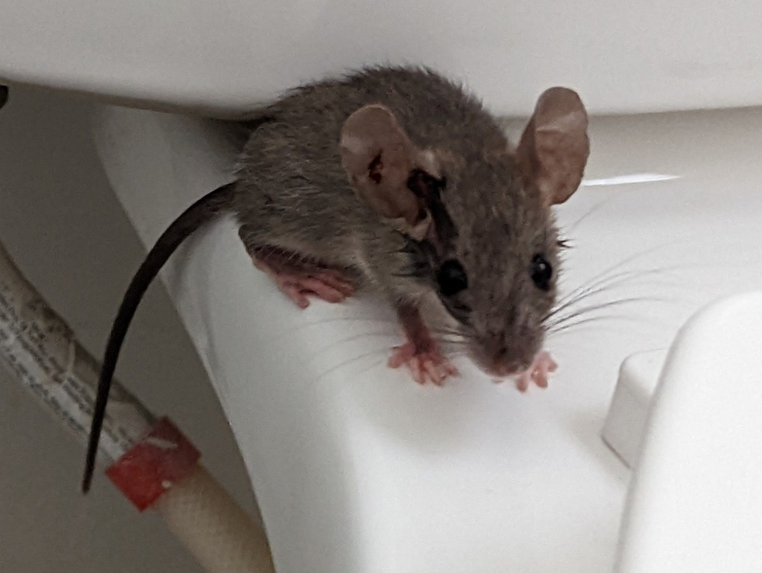
NEUR 411 · NEUROETHOLOGY · FALL 2026
Lecture 105B
Animal Cloning II: brain development, learning, temperament, and how genes, experience, and environment shape individuality in cloned animals.
Date TBD
Jordan Lopez, Ph.D.
Professor of Neurobiology & Biomedical Engineering
Photo: Mus musculus.
Notes:
Animal Cloning II: brain development, learning, temperament, and how genes, experience, and environment shape individuality in cloned animals.
Lecture 105B. Date TBD.
Figure: Photo: Mus musculus.
Figure source: https://www.inaturalist.org/observations/137177558
References:
Tamashiro KL, Wakayama T, Blanchard RJ, Blanchard DC, Yanagimachi R (2000). Postnatal growth and behavioral development of mice cloned from adult cumulus cells. Biology of reproduction 63(1):328-334. https://doi.org/10.1095/biolreprod63.1.328
Image: Photo: Mus musculus. Credit: (c) Justin, some rights reserved (CC BY). License: CC BY 4.0. Source: https://www.inaturalist.org/observations/137177558

Slide 2
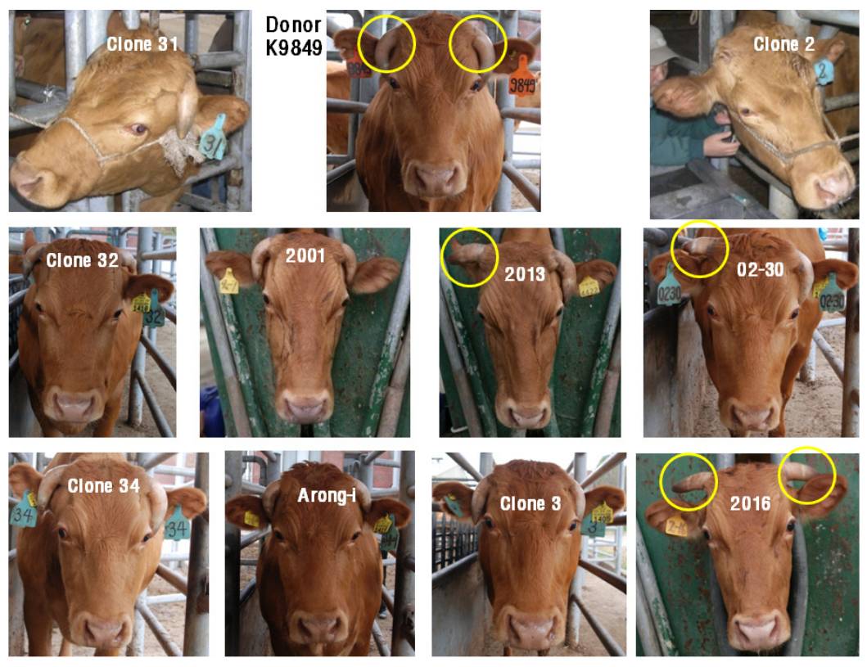
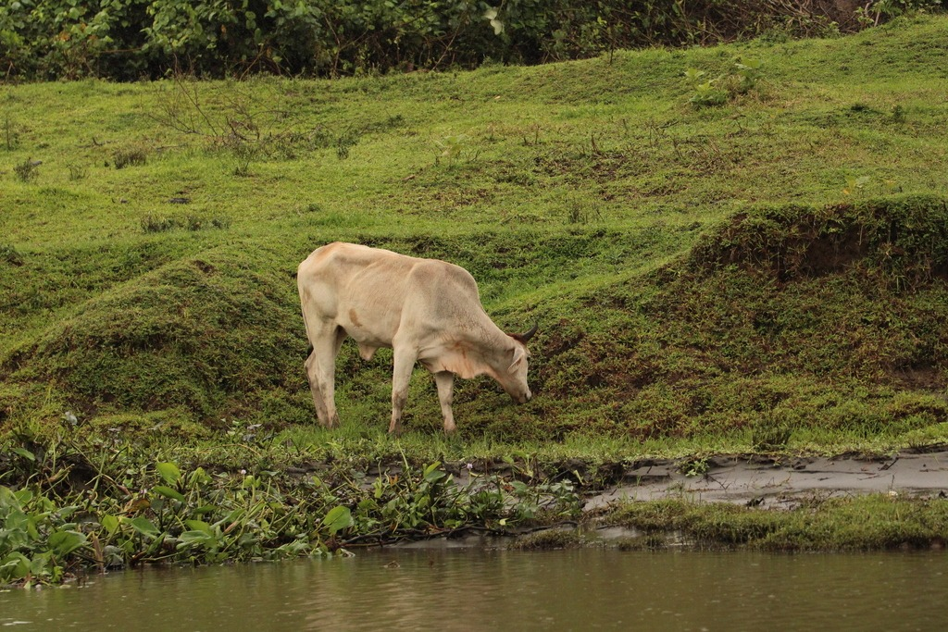
Shared nuclear origin permits individuality
Clones produced by somatic cell nuclear transfer share a nuclear genetic source. Their observable characteristics are called their phenotypes. A phenotype includes growth, appearance, physiology and behavior. A cattle study compared animals reconstructed from one adult donor. Similar nuclear origins coexisted with differences in several visible traits.
The investigators examined growth, horn patterns and noseprints. Some clones shared the donor’s horn pattern, whereas others differed. Noseprints distinguished the surviving animals from one another. The comparison therefore separated genetic relatedness from complete physical identity. Different traits also expressed different degrees of similarity within the same cloned group.
A donor nucleus develops within a new oocyte and pregnancy. The resulting animal then encounters its own postnatal environment. These events provide a new developmental history around a closely matched genome. The cattle results concern particular measured traits. They establish a biological setting in which individuality can be examined rather than assumed away by nuclear identity.
Yang et al. (2012), Fig. 1. Horn patterns of the donor cow and cloned Hanwoo cattle.
Photo: Bos taurus. Javier Sánchez Álvarez. CC BY 4.0.
Yang et al. (2012)
02
Notes:
• **Clones** produced by somatic cell nuclear transfer share a nuclear genetic source. Their observable characteristics are called their **phenotypes**. A phenotype includes growth, appearance, physiology and behavior. A cattle study compared animals reconstructed from one adult donor. Similar nuclear origins coexisted with differences in several visible traits.
• The investigators examined growth, horn patterns and noseprints. Some clones shared the donor’s horn pattern, whereas others differed. Noseprints distinguished the surviving animals from one another. The comparison therefore separated genetic relatedness from complete physical identity. Different traits also expressed different degrees of similarity within the same cloned group.
• A donor nucleus develops within a new oocyte and pregnancy. The resulting animal then encounters its own postnatal environment. These events provide a new developmental history around a closely matched genome. The cattle results concern particular measured traits. They establish a biological setting in which individuality can be examined rather than assumed away by nuclear identity.
References:
Yang BC, Lee SH, Hwang S, Lee HC, Im GS, Kim DH, Lee DK, Lee KT, Jeon IS, Oh SJ, Park SB (2012). Phenotypic characterization of Hanwoo (native Korean cattle) cloned from somatic cells of a single adult. BMB reports 45(1):38-43. https://doi.org/10.5483/bmbrep.2012.45.1.38
Figure: Yang et al. (2012), Fig. 1. Horn patterns of the donor cow and cloned Hanwoo cattle.
Figure source: https://doi.org/10.5483/bmbrep.2012.45.1.38
Image: Photo: Bos taurus. Credit: (c) Javier Sánchez Álvarez, some rights reserved (CC BY). License: CC BY 4.0. Source: https://www.inaturalist.org/observations/409684813

Slide 3
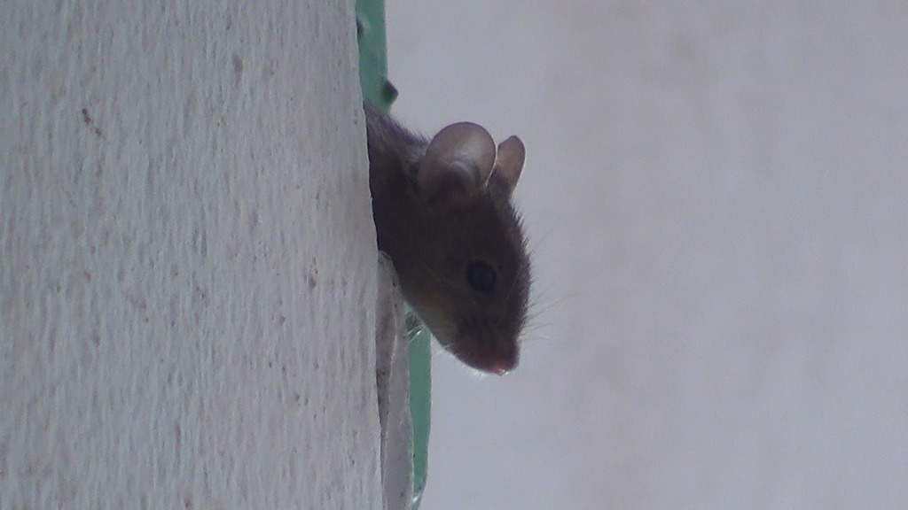
Early milestones and adult behavior differ
Tamashiro and colleagues followed mice cloned from adult cumulus-cell nuclei. Cumulus cells are somatic cells associated with the oocyte. The study compared their cloned offspring with controls designed around the production procedure. It assessed development before weaning and behavior later in life. The animals were therefore followed across different developmental timescales.
Some early developmental measures appeared later in the cloned mice. Other early measures did not share that delay. The pattern concerned selected milestones rather than a uniform delay in every observation. Developmental timing therefore required measurement across several functions. A single observation could not summarize the entire postnatal trajectory.
A developmental milestone is the appearance of a measurable developmental ability or feature. Its timing describes when that property emerges. Adult performance concerns how an established system functions later. The same animal can differ in early timing while reaching comparable later performance. Following both stages distinguishes developmental progression from a persistent behavioral difference.
Photo: Mus musculus. no rights reserved. CC0 1.0.
Tamashiro et al. (2000)
03
Notes:
• Tamashiro and colleagues followed mice cloned from adult cumulus-cell nuclei. **Cumulus cells** are somatic cells associated with the oocyte. The study compared their cloned offspring with controls designed around the production procedure. It assessed development before weaning and behavior later in life. The animals were therefore followed across different developmental timescales.
• Some early developmental measures appeared later in the cloned mice. Other early measures did not share that delay. The pattern concerned selected milestones rather than a uniform delay in every observation. Developmental timing therefore required measurement across several functions. A single observation could not summarize the entire postnatal trajectory.
• A **developmental milestone** is the appearance of a measurable developmental ability or feature. Its timing describes when that property emerges. Adult performance concerns how an established system functions later. The same animal can differ in early timing while reaching comparable later performance. Following both stages distinguishes developmental progression from a persistent behavioral difference.
References:
Tamashiro KL, Wakayama T, Blanchard RJ, Blanchard DC, Yanagimachi R (2000). Postnatal growth and behavioral development of mice cloned from adult cumulus cells. Biology of reproduction 63(1):328-334. https://doi.org/10.1095/biolreprod63.1.328
Image: Photo: Mus musculus. Credit: no rights reserved. License: CC0 1.0. Source: https://www.inaturalist.org/observations/409489732

Slide 4
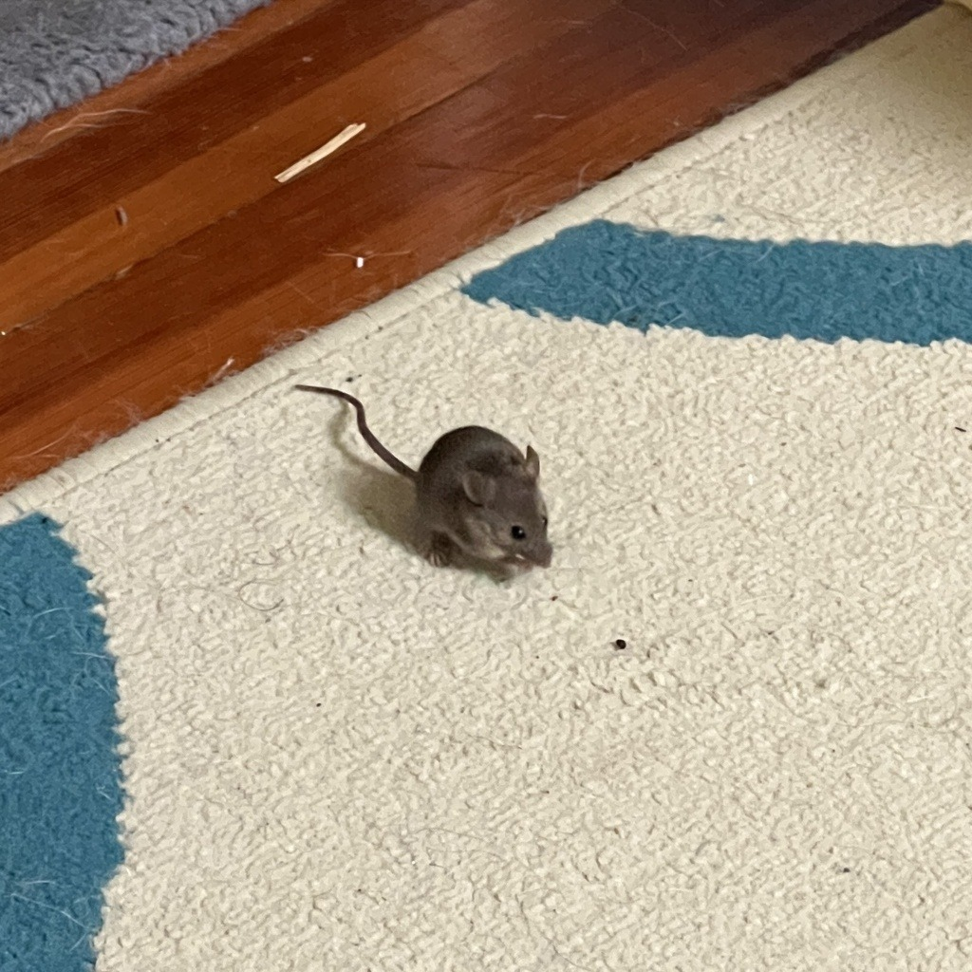
Adult performance can follow early delay
The cloned-mouse study assessed learning, memory, activity and motor skills after early development. These categories describe different functions. Learning concerns a change produced by experience. Memory concerns persistence of acquired information. Motor performance concerns the execution of movement rather than acquisition alone.
Adult outcomes were comparable between cloned mice and the study’s controls across the reported behavioral tests. This occurred despite delays in some early developmental measures. The developmental trajectory therefore changed over time. An early difference was not automatically a lasting deficit. The study connected preweaning observations with later functional assessment.
The control animals were selected to address features of the cloning procedure. This comparison related behavioral outcomes to a defined production method. Observing several functions also distinguished a broad activity change from a more specific performance change. The resulting profile combined developmental and adult measurements. Nuclear transfer was evaluated through the animals’ own postnatal trajectories.
Photo: Mus musculus. Carrie Seltzer. CC BY 4.0.
Tamashiro et al. (2000)
04
Notes:
• The cloned-mouse study assessed learning, memory, activity and motor skills after early development. These categories describe different functions. Learning concerns a change produced by experience. Memory concerns persistence of acquired information. Motor performance concerns the execution of movement rather than acquisition alone.
• Adult outcomes were comparable between cloned mice and the study’s controls across the reported behavioral tests. This occurred despite delays in some early developmental measures. The developmental trajectory therefore changed over time. An early difference was not automatically a lasting deficit. The study connected preweaning observations with later functional assessment.
• The control animals were selected to address features of the cloning procedure. This comparison related behavioral outcomes to a defined production method. Observing several functions also distinguished a broad activity change from a more specific performance change. The resulting profile combined developmental and adult measurements. Nuclear transfer was evaluated through the animals’ own postnatal trajectories.
References:
Tamashiro KL, Wakayama T, Blanchard RJ, Blanchard DC, Yanagimachi R (2000). Postnatal growth and behavioral development of mice cloned from adult cumulus cells. Biology of reproduction 63(1):328-334. https://doi.org/10.1095/biolreprod63.1.328
Image: Photo: Mus musculus. Credit: (c) Carrie Seltzer, some rights reserved (CC BY). License: CC BY 4.0. Source: https://www.inaturalist.org/observations/185636752

Slide 5
Obesity in clones need not recur in offspring
The cloned-mouse follow-up examined increased body weight in adult animals. Adiposity means the amount of body fat. The investigators found that the increase included greater fat accumulation as well as body size. Weight alone therefore did not describe the full physiological change. Body composition added information about the phenotype.
The study also examined offspring produced by mating cloned mice. These offspring were conceived through sexual reproduction. They did not inherit the same obesity phenotype. This comparison separated a phenotype in SCNT-derived animals from its recurrence in a subsequent generation. The finding changes how the original difference should be interpreted.
A heritable trait is transmitted across generations through inherited biological contributions. A trait observed in a clone need not behave as a fixed sequence mutation. The follow-up connected adult physiology with reproductive outcomes. It therefore tested persistence across a different developmental route. Phenotypic similarity and inheritance require separate measurements even within closely related animals.
Photo: Mus musculus. no rights reserved. CC0 1.0.
Tamashiro et al. (2002)
05
Notes:
• The cloned-mouse follow-up examined increased body weight in adult animals. **Adiposity** means the amount of body fat. The investigators found that the increase included greater fat accumulation as well as body size. Weight alone therefore did not describe the full physiological change. Body composition added information about the phenotype.
• The study also examined offspring produced by mating cloned mice. These offspring were conceived through sexual reproduction. They did not inherit the same obesity phenotype. This comparison separated a phenotype in SCNT-derived animals from its recurrence in a subsequent generation. The finding changes how the original difference should be interpreted.
• A **heritable** trait is transmitted across generations through inherited biological contributions. A trait observed in a clone need not behave as a fixed sequence mutation. The follow-up connected adult physiology with reproductive outcomes. It therefore tested persistence across a different developmental route. Phenotypic similarity and inheritance require separate measurements even within closely related animals.
References:
Tamashiro KL, Wakayama T, Akutsu H, Yamazaki Y, Lachey JL, Wortman MD, Seeley RJ, D'Alessio DA, Woods SC, Yanagimachi R, Sakai RR (2002). Cloned mice have an obese phenotype not transmitted to their offspring. Nature medicine 8(3):262-267. https://doi.org/10.1038/nm0302-262
Image: Photo: Mus musculus. Credit: no rights reserved. License: CC0 1.0. Source: https://www.inaturalist.org/observations/409489732

Slide 6
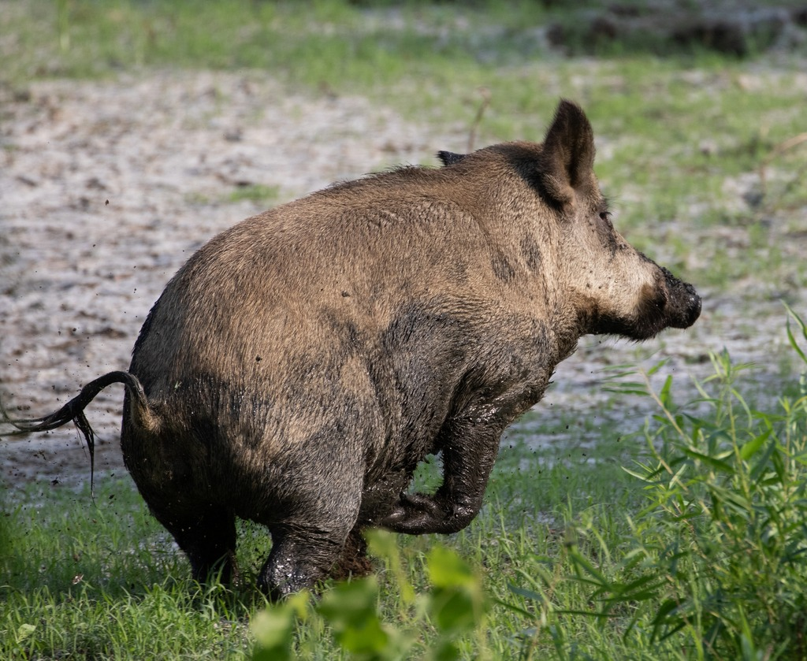
Trait variability depends on the trait
A pig study compared adult SCNT animals with naturally bred controls. It examined physiological traits and selected molecular properties. Some traits varied less among clones than among controls. Other traits remained similarly variable across the groups. Nuclear cloning therefore did not reduce every form of biological variation equally.
Within-group variation describes differences among animals assigned to the same group. It is distinct from a difference between group averages. Two groups can have similar average values while containing different patterns of individuality. The pig study assessed several traits rather than assuming one uniform pattern. The effects of shared nuclear origin depended on the property measured.
The investigators also examined methylation at selected genomic regions. DNA methylation is a chemical DNA modification involved in regulation. Molecular comparisons supplied another description of differences among the animals. The combined approach linked physiological phenotype with aspects of genomic regulation. A shared cloning method therefore became the start of a trait-specific comparison rather than a guarantee of uniformity.
Photo: Sus scrofa domesticus. Cullen Hanks. CC BY 4.0.
Archer et al. (2003)
06
Notes:
• A pig study compared adult SCNT animals with naturally bred controls. It examined physiological traits and selected molecular properties. Some traits varied less among clones than among controls. Other traits remained similarly variable across the groups. Nuclear cloning therefore did not reduce every form of biological variation equally.
• **Within-group variation** describes differences among animals assigned to the same group. It is distinct from a difference between group averages. Two groups can have similar average values while containing different patterns of individuality. The pig study assessed several traits rather than assuming one uniform pattern. The effects of shared nuclear origin depended on the property measured.
• The investigators also examined methylation at selected genomic regions. **DNA methylation** is a chemical DNA modification involved in regulation. Molecular comparisons supplied another description of differences among the animals. The combined approach linked physiological phenotype with aspects of genomic regulation. A shared cloning method therefore became the start of a trait-specific comparison rather than a guarantee of uniformity.
References:
Archer GS, Dindot S, Friend TH, Walker S, Zaunbrecher G, Lawhorn B, Piedrahita JA (2003). Hierarchical phenotypic and epigenetic variation in cloned swine. Biology of reproduction 69(2):430-436. https://doi.org/10.1095/biolreprod.103.016147
Image: Photo: Sus scrofa domesticus. Credit: (c) Cullen Hanks, some rights reserved (CC BY). License: CC BY 4.0. Source: https://www.inaturalist.org/observations/22481962

Slide 7
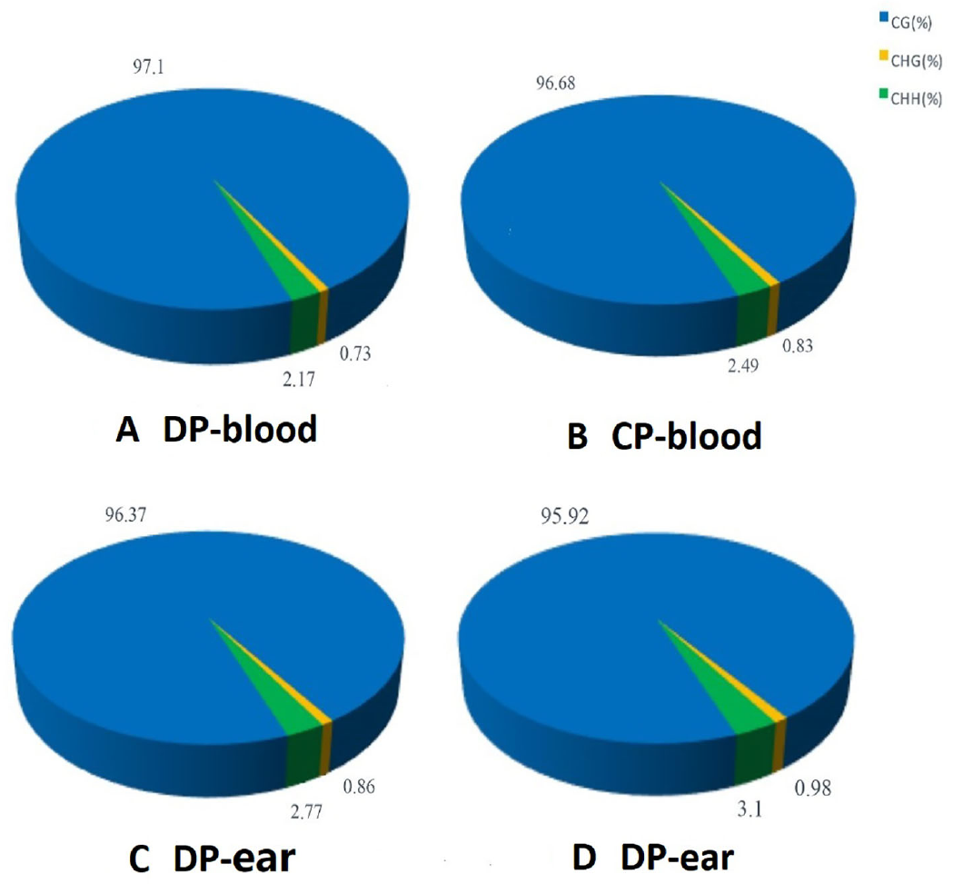
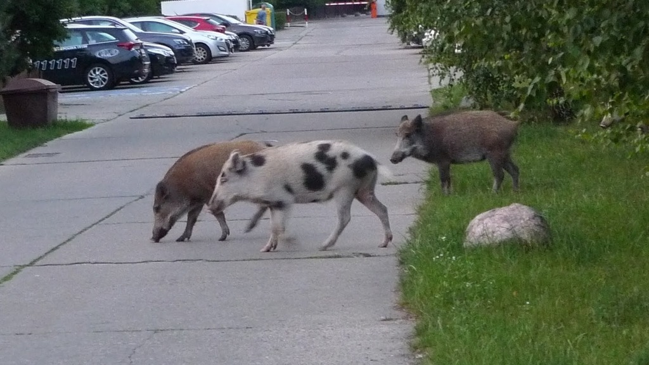
Donor and clone methylation patterns differ
A pig methylation study compared donor and cloned-animal samples. DNA methylation can vary across genomic regions. It can also differ among tissues. The experiment measured methylation profiles rather than inferring them from external resemblance. This made regulatory state a directly examined feature of the cloned animals.
A DNA sequence and its methylation pattern are different properties. Sequence specifies the arrangement of nucleotide bases. Methylation describes a chemical state associated with those bases. An animal can closely match a donor’s sequence while differing in regulatory marks. Measuring these properties separately clarifies what genetic identity actually establishes.
Cells within an animal also perform different functions. Their molecular states reflect tissue specialization and developmental history. Tissue-matched comparisons are consequently important when evaluating donor–clone differences. The pig data place molecular individuality alongside physical phenotype. Nuclear transfer can preserve a genetic source while a new animal develops its own regulatory states.
Wang et al. (2020), Fig. 1. Published methylation profiles in donor and cloned-pig samples.
Photo: Sus scrofa. aga_l_. CC BY 4.0.
Wang et al. (2020)
07
Notes:
• A pig methylation study compared donor and cloned-animal samples. DNA methylation can vary across genomic regions. It can also differ among tissues. The experiment measured methylation profiles rather than inferring them from external resemblance. This made regulatory state a directly examined feature of the cloned animals.
• A DNA sequence and its methylation pattern are different properties. Sequence specifies the arrangement of nucleotide bases. Methylation describes a chemical state associated with those bases. An animal can closely match a donor’s sequence while differing in regulatory marks. Measuring these properties separately clarifies what genetic identity actually establishes.
• Cells within an animal also perform different functions. Their molecular states reflect tissue specialization and developmental history. Tissue-matched comparisons are consequently important when evaluating donor–clone differences. The pig data place molecular individuality alongside physical phenotype. Nuclear transfer can preserve a genetic source while a new animal develops its own regulatory states.
References:
Wang M, Feng S, Ma G, Miao Y, Zuo B, Ruan J, Zhao S, Wang H, Du X, Liu X (2020). Whole-Genome Methylation Analysis Reveals Epigenetic Variation in Cloned and Donor Pigs. Frontiers in genetics 11:23. https://doi.org/10.3389/fgene.2020.00023
Figure: Wang et al. (2020), Fig. 1. Published methylation profiles in donor and cloned-pig samples.
Figure source: https://doi.org/10.3389/fgene.2020.00023
Image: Photo: Sus scrofa. Credit: (c) aga_l_, some rights reserved (CC BY). License: CC BY 4.0. Source: https://www.inaturalist.org/observations/171076616

Slide 8
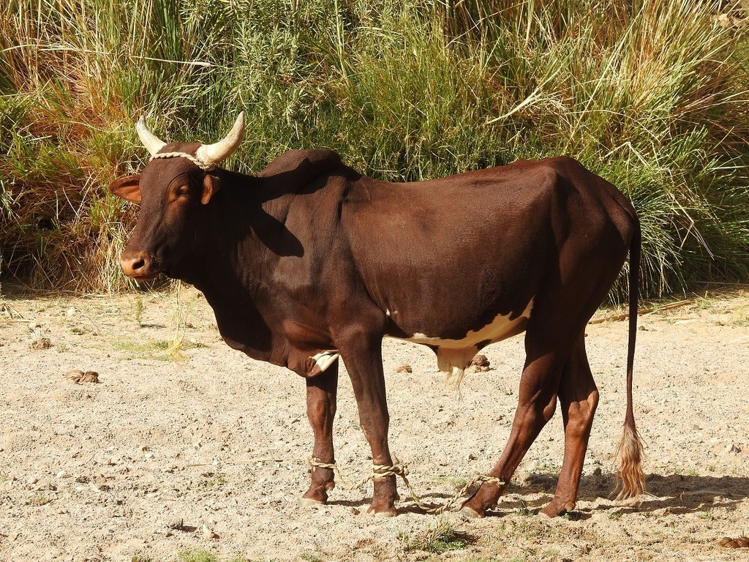
Cattle share some horn patterns
The Hanwoo study examined cattle reconstructed from one adult donor. Investigators compared growth and external anatomical patterns. Most of the examined clones shared the donor’s horn pattern. Others developed different patterns. The same donor origin therefore supported both resemblance and difference within one anatomical feature.
A horn pattern is an observable developmental characteristic of the animal. Its assessment differs from an assay of nuclear DNA identity. The study measured both general appearance and more specific traits. This prevented resemblance from being treated as a single all-or-none property. Similarity depended on the feature used to compare the animals.
Growth supplied another developmental comparison. The cloned cattle could differ from the donor in weight at matched observation points. Their bodies developed through separate pregnancies and postnatal histories. The external measurements recorded the outcomes of those histories. Shared nuclear origin therefore coexisted with trait-specific patterns of development.
Yang et al. (2012), Fig. 1. Horn patterns of the donor cow and cloned Hanwoo cattle.
Photo: Bos taurus indicus. Karim Haddad. CC BY 4.0.
Yang et al. (2012)
08
Notes:
• The Hanwoo study examined cattle reconstructed from one adult donor. Investigators compared growth and external anatomical patterns. Most of the examined clones shared the donor’s horn pattern. Others developed different patterns. The same donor origin therefore supported both resemblance and difference within one anatomical feature.
• A **horn pattern** is an observable developmental characteristic of the animal. Its assessment differs from an assay of nuclear DNA identity. The study measured both general appearance and more specific traits. This prevented resemblance from being treated as a single all-or-none property. Similarity depended on the feature used to compare the animals.
• Growth supplied another developmental comparison. The cloned cattle could differ from the donor in weight at matched observation points. Their bodies developed through separate pregnancies and postnatal histories. The external measurements recorded the outcomes of those histories. Shared nuclear origin therefore coexisted with trait-specific patterns of development.
References:
Yang BC, Lee SH, Hwang S, Lee HC, Im GS, Kim DH, Lee DK, Lee KT, Jeon IS, Oh SJ, Park SB (2012). Phenotypic characterization of Hanwoo (native Korean cattle) cloned from somatic cells of a single adult. BMB reports 45(1):38-43. https://doi.org/10.5483/bmbrep.2012.45.1.38
Figure: Yang et al. (2012), Fig. 1. Horn patterns of the donor cow and cloned Hanwoo cattle.
Figure source: https://doi.org/10.5483/bmbrep.2012.45.1.38
Image: Photo: Bos taurus indicus. Credit: (c) Karim Haddad, some rights reserved (CC BY). License: CC BY 4.0. Source: https://www.inaturalist.org/observations/48044729

Slide 9
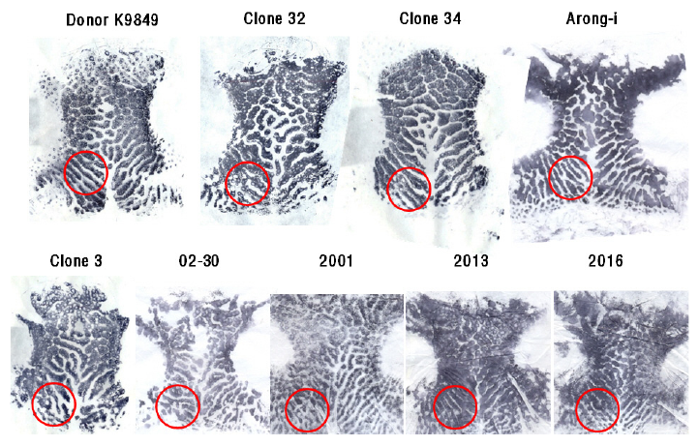
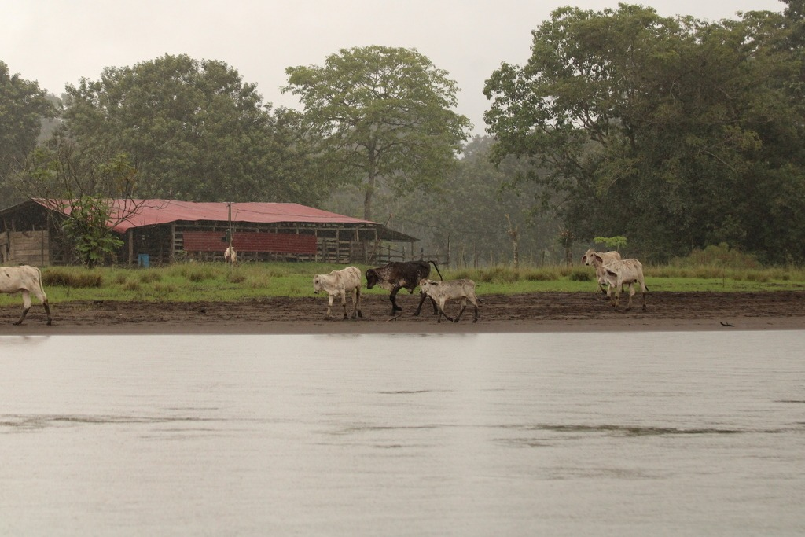
Noseprints distinguish cloned cattle
The noseprint study examined detailed surface patterns in cloned cattle. A noseprint records the arrangement of visible markings on the muzzle. The surviving clones had distinct noseprints. Some patterns resembled the donor more closely than others. Individual animals could therefore be distinguished within a group of nuclear relatives.
The investigators compared the patterns directly rather than classifying the animals only by general appearance. A broad resemblance and a detailed individual pattern are different levels of description. Both can occur in the same animal. The noseprint results made that distinction measurable. Nuclear genetic matching did not collapse the animals into one externally identical phenotype.
A developmental process produces the final arrangement of a tissue surface. The genome contributes to that process alongside cellular growth and organization. The cattle study recorded the resulting individual patterns. It did not need to assign every difference to one molecular cause. The observed phenotype itself established that individuality remained present within the cloned group.
Yang et al. (2012), Fig. 2. Distinct noseprint patterns in cattle with a common nuclear donor.
Photo: Bos taurus. Javier Sánchez Álvarez. CC BY 4.0.
Yang et al. (2012)
09
Notes:
• The noseprint study examined detailed surface patterns in cloned cattle. A **noseprint** records the arrangement of visible markings on the muzzle. The surviving clones had distinct noseprints. Some patterns resembled the donor more closely than others. Individual animals could therefore be distinguished within a group of nuclear relatives.
• The investigators compared the patterns directly rather than classifying the animals only by general appearance. A broad resemblance and a detailed individual pattern are different levels of description. Both can occur in the same animal. The noseprint results made that distinction measurable. Nuclear genetic matching did not collapse the animals into one externally identical phenotype.
• A developmental process produces the final arrangement of a tissue surface. The genome contributes to that process alongside cellular growth and organization. The cattle study recorded the resulting individual patterns. It did not need to assign every difference to one molecular cause. The observed phenotype itself established that individuality remained present within the cloned group.
References:
Yang BC, Lee SH, Hwang S, Lee HC, Im GS, Kim DH, Lee DK, Lee KT, Jeon IS, Oh SJ, Park SB (2012). Phenotypic characterization of Hanwoo (native Korean cattle) cloned from somatic cells of a single adult. BMB reports 45(1):38-43. https://doi.org/10.5483/bmbrep.2012.45.1.38
Figure: Yang et al. (2012), Fig. 2. Distinct noseprint patterns in cattle with a common nuclear donor.
Figure source: https://doi.org/10.5483/bmbrep.2012.45.1.38
Image: Photo: Bos taurus. Credit: (c) Javier Sánchez Álvarez, some rights reserved (CC BY). License: CC BY 4.0. Source: https://www.inaturalist.org/observations/409684738

Slide 10
Juvenile clones develop their own behavior
A behavioral study followed juvenile heifers cloned from an aged adult donor. Heifers are young female cattle that have not yet calved. Investigators compared them with animals of similar chronological age. They observed play, movement, vocalization and other behaviors. The comparison tested the behavior of the newly developed animals rather than assuming the donor’s age transferred with its nucleus.
The juvenile clones did not display a broadly aged behavioral profile. Several behaviors resembled those of their age-matched controls. The study also reported differences in particular behavioral tendencies. These included play and measures associated with exploration and social interaction. The result was a behavioral profile rather than a single identity score.
Chronological age measures time in an animal’s own life. It is different from the age of the original nuclear donor. The heifers developed through new pregnancies and grew after their own births. Their activity occurred within those developmental histories. Comparing them with age-matched cattle connected nuclear cloning with the behavior of the resulting juvenile animals.
Photo: Bos taurus. Javier Sánchez Álvarez. CC BY 4.0.
Savage et al. (2003)
10
Notes:
• A behavioral study followed juvenile heifers cloned from an aged adult donor. **Heifers** are young female cattle that have not yet calved. Investigators compared them with animals of similar chronological age. They observed play, movement, vocalization and other behaviors. The comparison tested the behavior of the newly developed animals rather than assuming the donor’s age transferred with its nucleus.
• The juvenile clones did not display a broadly aged behavioral profile. Several behaviors resembled those of their age-matched controls. The study also reported differences in particular behavioral tendencies. These included play and measures associated with exploration and social interaction. The result was a behavioral profile rather than a single identity score.
• **Chronological age** measures time in an animal’s own life. It is different from the age of the original nuclear donor. The heifers developed through new pregnancies and grew after their own births. Their activity occurred within those developmental histories. Comparing them with age-matched cattle connected nuclear cloning with the behavior of the resulting juvenile animals.
References:
Savage AF, Maull J, Tian XC, Taneja M, Katz L, Darre M, Yang X (2003). Behavioral observations of adolescent Holstein heifers cloned from adult somatic cells. Theriogenology 60(6):1097-1110. https://doi.org/10.1016/s0093-691x(03)00110-9
Image: Photo: Bos taurus. Credit: (c) Javier Sánchez Álvarez, some rights reserved (CC BY). License: CC BY 4.0. Source: https://www.inaturalist.org/observations/409684813

Slide 11
Heifers form preferential social associations
The social study observed a herd containing cloned and artificially inseminated heifers. Some clones shared one donor, while others came from another donor. Investigators measured spatial association and social interaction. Animals from the same donor associated more strongly with one another. The observation linked donor-related similarity with the pattern of grouping within the herd.
Spatial association concerns which animals remain near each other. It differs from a direct measure of every social interaction. The study examined both proximity and interaction patterns. This provided complementary descriptions of grouping. A preference could therefore be assessed through more than one behavioral observation.
The animals also shared a social environment. Familiarity and visible resemblance could contribute to recognition within that environment. The investigators consequently added a separate discrimination task. That task examined the information cattle could use to distinguish individuals. Social association and individual recognition were treated as related but separately measurable behaviors.
Photo: Bos taurus. Javier Sánchez Álvarez. CC BY 4.0.
Coulon et al. (2010)
11
Notes:
• The social study observed a herd containing cloned and artificially inseminated heifers. Some clones shared one donor, while others came from another donor. Investigators measured spatial association and social interaction. Animals from the same donor associated more strongly with one another. The observation linked donor-related similarity with the pattern of grouping within the herd.
• **Spatial association** concerns which animals remain near each other. It differs from a direct measure of every social interaction. The study examined both proximity and interaction patterns. This provided complementary descriptions of grouping. A preference could therefore be assessed through more than one behavioral observation.
• The animals also shared a social environment. Familiarity and visible resemblance could contribute to recognition within that environment. The investigators consequently added a separate discrimination task. That task examined the information cattle could use to distinguish individuals. Social association and individual recognition were treated as related but separately measurable behaviors.
References:
Coulon M, Baudoin C, Abdi H, Heyman Y, Deputte BL (2010). Social behavior and kin discrimination in a mixed group of cloned and non cloned heifers (Bos taurus). Theriogenology 74(9):1596-1603. https://doi.org/10.1016/j.theriogenology.2010.06.031
Image: Photo: Bos taurus. Credit: (c) Javier Sánchez Álvarez, some rights reserved (CC BY). License: CC BY 4.0. Source: https://www.inaturalist.org/observations/409684813

Slide 12
Cattle discriminate familiar visual features
The cattle study used photographs of familiar heifers in a food-reward task. Instrumental conditioning means learning that an action produces a particular outcome. Here, successful discrimination was associated with food. Both cloned and non-cloned cattle learned to distinguish the image categories. The task connected social recognition with an acquired visual response.
The image categories included related clones and familiar unrelated animals. Cattle could use morphological similarities characteristic of the related animals. Morphology refers to physical form and structure. The discrimination therefore involved information available in appearance. It did not require the animals to identify genetic relatedness through direct access to DNA.
The behavioral result complemented observation of herd associations. Proximity measured which animals grouped together. The conditioning experiment tested a possible recognition process. Both cloned and artificially inseminated animals performed the discrimination. The study therefore placed shared donor origin within a broader system of familiarity, perception and learning.
Photo: Bos taurus. Javier Sánchez Álvarez. CC BY 4.0.
Coulon et al. (2010)
12
Notes:
• The cattle study used photographs of familiar heifers in a food-reward task. **Instrumental conditioning** means learning that an action produces a particular outcome. Here, successful discrimination was associated with food. Both cloned and non-cloned cattle learned to distinguish the image categories. The task connected social recognition with an acquired visual response.
• The image categories included related clones and familiar unrelated animals. Cattle could use morphological similarities characteristic of the related animals. **Morphology** refers to physical form and structure. The discrimination therefore involved information available in appearance. It did not require the animals to identify genetic relatedness through direct access to DNA.
• The behavioral result complemented observation of herd associations. Proximity measured which animals grouped together. The conditioning experiment tested a possible recognition process. Both cloned and artificially inseminated animals performed the discrimination. The study therefore placed shared donor origin within a broader system of familiarity, perception and learning.
References:
Coulon M, Baudoin C, Abdi H, Heyman Y, Deputte BL (2010). Social behavior and kin discrimination in a mixed group of cloned and non cloned heifers (Bos taurus). Theriogenology 74(9):1596-1603. https://doi.org/10.1016/j.theriogenology.2010.06.031
Image: Photo: Bos taurus. Credit: (c) Javier Sánchez Álvarez, some rights reserved (CC BY). License: CC BY 4.0. Source: https://www.inaturalist.org/observations/409684813

Slide 13
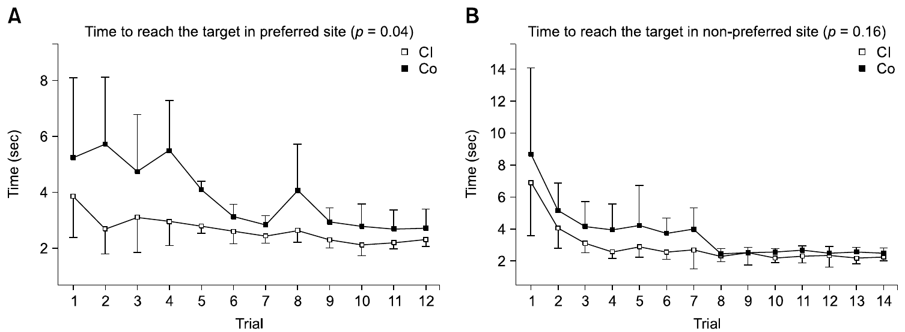
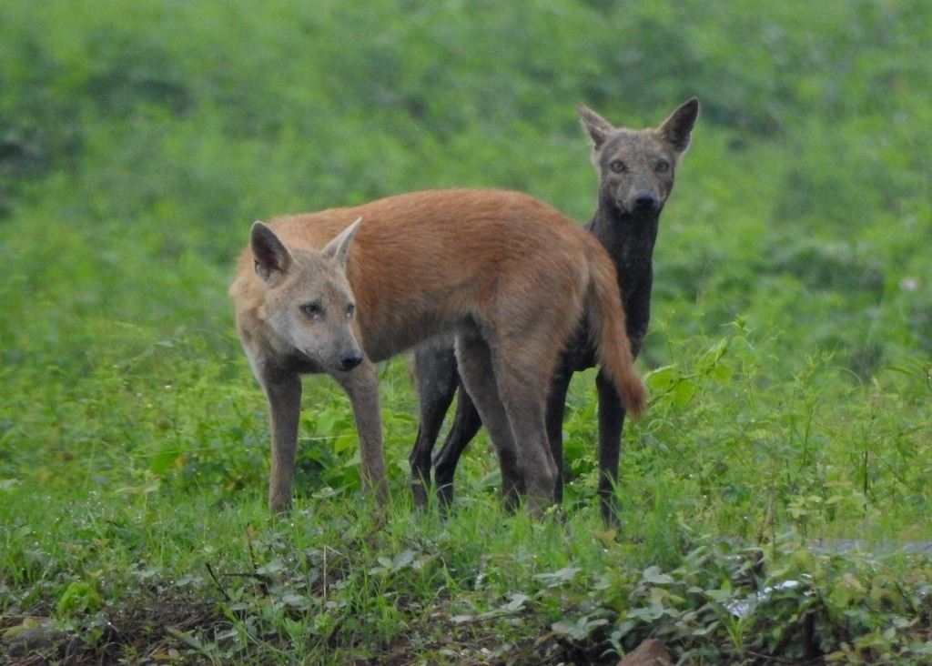
Cloned dogs provide a learning comparison
Shin and colleagues compared cloned beagles with age-matched control beagles. The clones came from a common somatic-cell donor. The investigators assessed learning and exploration in adulthood. These functions were measured through separate behavioral procedures. The design distinguished a shared nuclear source from the actual performance of the resulting dogs.
The learning procedure rewarded finding food on one side of a maze. Repeated trials allowed the dogs to acquire the rewarded response. A reversal then changed the previously preferred relationship. Reversal learning measures adjustment when a learned rule changes. It therefore examines flexibility in addition to initial acquisition.
The study found reduced variation among clones in some learning-related measures. That pattern concerned particular measured behaviors. It did not require every dog to make the same sequence of choices. Comparing individual responses remained necessary. The experiment related nuclear similarity to the distribution of task performance rather than treating genetic matching as behavioral identity.
Shin et al. (2016), Fig. 1(A–B). Target latencies during learning and reversal in cloned and control dogs.
Photo: Canis familiaris. Afsar Nayakkan. CC BY 4.0.
Shin et al. (2016)
13
Notes:
• Shin and colleagues compared cloned beagles with age-matched control beagles. The clones came from a common somatic-cell donor. The investigators assessed learning and exploration in adulthood. These functions were measured through separate behavioral procedures. The design distinguished a shared nuclear source from the actual performance of the resulting dogs.
• The learning procedure rewarded finding food on one side of a maze. Repeated trials allowed the dogs to acquire the rewarded response. A reversal then changed the previously preferred relationship. **Reversal learning** measures adjustment when a learned rule changes. It therefore examines flexibility in addition to initial acquisition.
• The study found reduced variation among clones in some learning-related measures. That pattern concerned particular measured behaviors. It did not require every dog to make the same sequence of choices. Comparing individual responses remained necessary. The experiment related nuclear similarity to the distribution of task performance rather than treating genetic matching as behavioral identity.
References:
Shin CW, Kim GA, Park WJ, Park KY, Jeon JM, Oh HJ, Kim MJ, Lee BC (2016). Learning, memory and exploratory similarities in genetically identical cloned dogs. Journal of veterinary science 17(4):563-567. https://doi.org/10.4142/jvs.2016.17.4.563
Figure: Shin et al. (2016), Fig. 1(A–B). Target latencies during learning and reversal in cloned and control dogs.
Figure source: https://doi.org/10.4142/jvs.2016.17.4.563
Image: Photo: Canis familiaris. Credit: (c) Afsar Nayakkan, some rights reserved (CC BY). License: CC BY 4.0. Source: https://www.inaturalist.org/observations/126460638

Slide 14
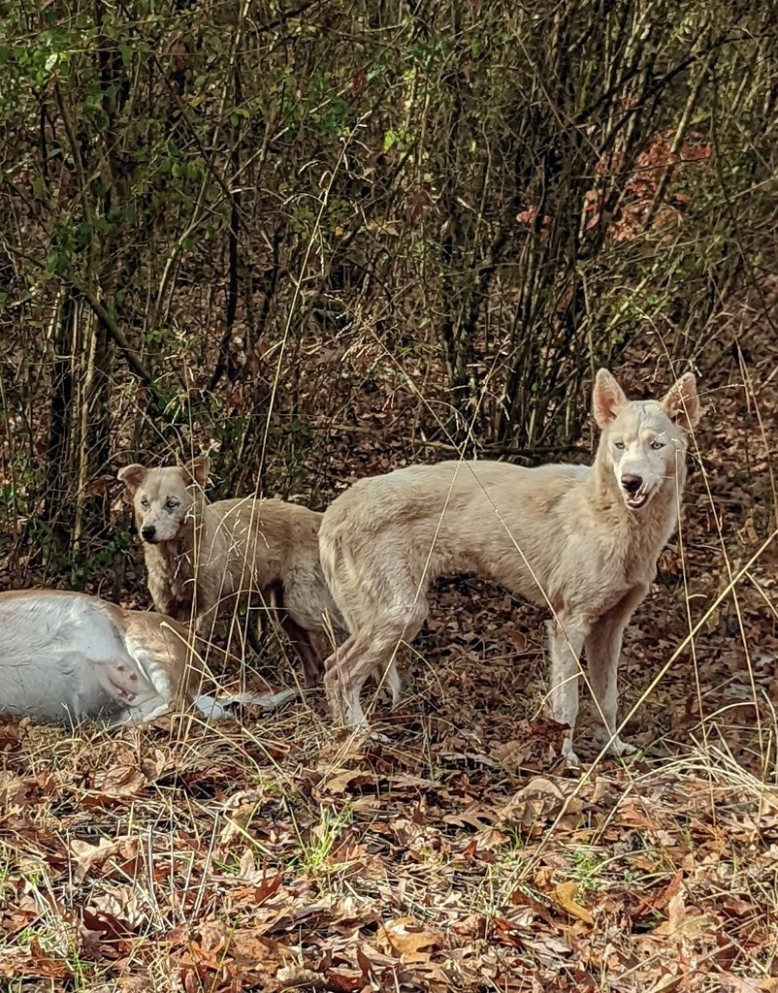
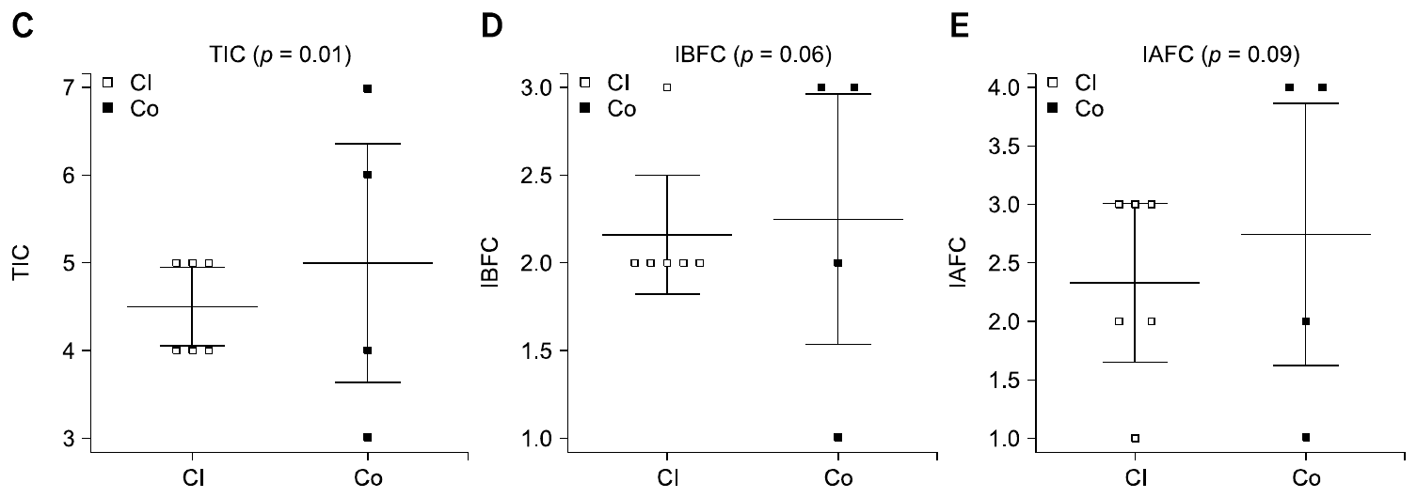
Choices and latencies index performance
Acquisition is the development of a learned response through experience. The cloned-dog study trained dogs to find food on a preferred side. Investigators then changed the rewarded relationship during reversal learning. Correct and incorrect choices recorded how the dogs responded. The time taken to reach the target supplied another performance measure.
An incorrect turn and a long completion time describe different actions. A dog can reach the correct location slowly. It can also move quickly while choosing incorrectly. The investigators therefore examined several measures rather than one overall score. Initial acquisition and adjustment after reversal supplied different parts of the learning history.
The dogs encountered rewards after their own choices. Earlier trials therefore became part of the context for later responses. Nuclear similarity could be compared against the resulting behavioral patterns. Each dog still acquired its own sequence of task experiences. The experiment connected shared nuclear origin with measured learning rather than an inherited record of the donor’s choices.
Shin et al. (2016), Fig. 1(C–E). Incorrect choices in cloned and control dogs.
Photo: Canis familiaris. no rights reserved. CC0 1.0.
Shin et al. (2016)
14
Notes:
• **Acquisition** is the development of a learned response through experience. The cloned-dog study trained dogs to find food on a preferred side. Investigators then changed the rewarded relationship during reversal learning. Correct and incorrect choices recorded how the dogs responded. The time taken to reach the target supplied another performance measure.
• An incorrect turn and a long completion time describe different actions. A dog can reach the correct location slowly. It can also move quickly while choosing incorrectly. The investigators therefore examined several measures rather than one overall score. Initial acquisition and adjustment after reversal supplied different parts of the learning history.
• The dogs encountered rewards after their own choices. Earlier trials therefore became part of the context for later responses. Nuclear similarity could be compared against the resulting behavioral patterns. Each dog still acquired its own sequence of task experiences. The experiment connected shared nuclear origin with measured learning rather than an inherited record of the donor’s choices.
References:
Shin CW, Kim GA, Park WJ, Park KY, Jeon JM, Oh HJ, Kim MJ, Lee BC (2016). Learning, memory and exploratory similarities in genetically identical cloned dogs. Journal of veterinary science 17(4):563-567. https://doi.org/10.4142/jvs.2016.17.4.563
Figure: Shin et al. (2016), Fig. 1(C–E). Incorrect choices in cloned and control dogs.
Figure source: https://doi.org/10.4142/jvs.2016.17.4.563
Image: Photo: Canis familiaris. Credit: no rights reserved. License: CC0 1.0. Source: https://www.inaturalist.org/observations/143194050

Slide 15
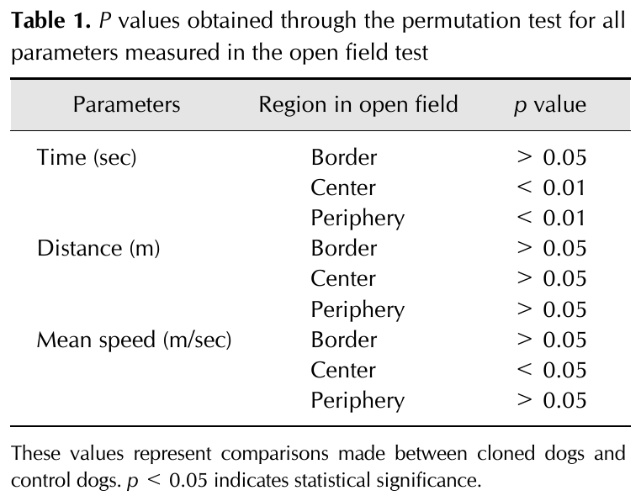
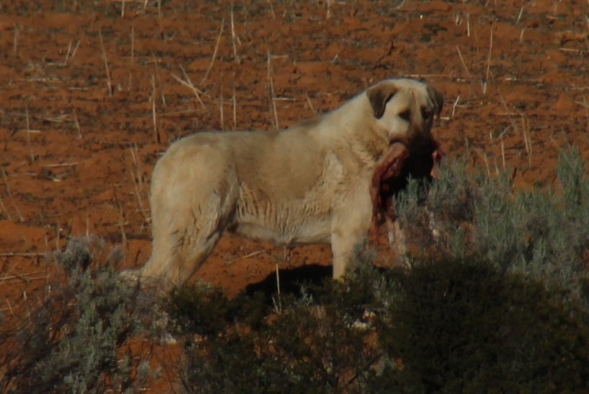
Exploration differs from maze performance
The cloned-dog study also measured behavior in an open-field setting. Exploration describes investigation and movement within an environment. It differs from following a rewarded maze rule. The two procedures therefore sampled different behavioral properties. An animal’s performance in one task could not stand in for every aspect of its behavior.
The investigators examined differences among individuals as well as group performance. Some behavioral measures varied less among the cloned animals. The pattern depended on the measure being considered. Comparing exploration with learning therefore produced a more differentiated behavioral profile. Shared donor origin was evaluated across more than one kind of task.
An open field supplies a setting without the same learned left-or-right rule as the maze. Movement and investigation can be recorded within that setting. Maze behavior instead depends on the relationship between a choice and reward. These preparations place different demands on the animal. Their comparison distinguishes behavioral domains that might otherwise be compressed into a single temperament label.
Shin et al. (2016), Table 1. Original comparisons of open-field time, distance and speed measures.
Photo: Canis familiaris. Tony Rebelo. CC BY-SA 4.0.
Shin et al. (2016)
15
Notes:
• The cloned-dog study also measured behavior in an open-field setting. **Exploration** describes investigation and movement within an environment. It differs from following a rewarded maze rule. The two procedures therefore sampled different behavioral properties. An animal’s performance in one task could not stand in for every aspect of its behavior.
• The investigators examined differences among individuals as well as group performance. Some behavioral measures varied less among the cloned animals. The pattern depended on the measure being considered. Comparing exploration with learning therefore produced a more differentiated behavioral profile. Shared donor origin was evaluated across more than one kind of task.
• An open field supplies a setting without the same learned left-or-right rule as the maze. Movement and investigation can be recorded within that setting. Maze behavior instead depends on the relationship between a choice and reward. These preparations place different demands on the animal. Their comparison distinguishes behavioral domains that might otherwise be compressed into a single temperament label.
References:
Shin CW, Kim GA, Park WJ, Park KY, Jeon JM, Oh HJ, Kim MJ, Lee BC (2016). Learning, memory and exploratory similarities in genetically identical cloned dogs. Journal of veterinary science 17(4):563-567. https://doi.org/10.4142/jvs.2016.17.4.563
Figure: Shin et al. (2016), Table 1. Original comparisons of open-field time, distance and speed measures.
Figure source: https://doi.org/10.4142/jvs.2016.17.4.563
Image: Photo: Canis familiaris. Credit: (c) Tony Rebelo, some rights reserved (CC BY-SA). License: CC BY-SA 4.0. Source: https://www.inaturalist.org/observations/9194991

Slide 16
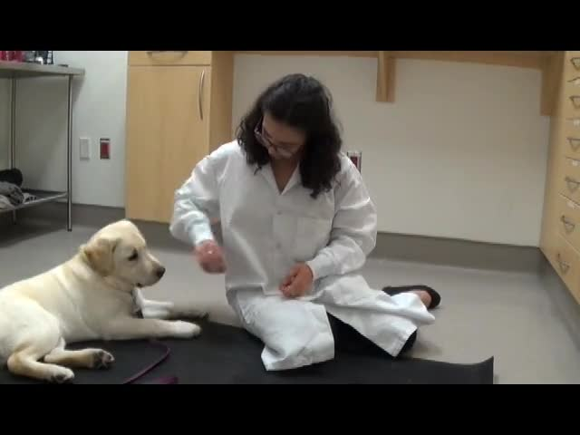
Temperament tests sample different responses
Temperament refers to relatively consistent tendencies in how an animal responds. The cloned-working-dog study examined several measured behavioral characteristics. It compared dogs rather than assuming that one successful donor defined every later response. Different tests placed the animals in different situations. Their behavior could consequently be described across more than one response category.
A tendency observed in one situation can differ from performance in another. A working assessment also includes acquired skills. The study’s test measures therefore addressed particular components of behavior. They were not interchangeable measures of a complete personality. Evaluating the components separately preserved differences among individual cloned dogs.
The expression of temperament occurs through interaction with an environment. A test supplies stimuli, handling and opportunities for response. The resulting observation describes the animal in that context. Repeated assessment can establish whether a tendency persists. The cloned-dog work connects shared nuclear origin with directly measured variation in behavioral responses. A separate non-cloned-dog intervention changed some handling-related fear responses.
Photo: Canis familiaris. Afsar Nayakkan. CC BY 4.0.
Stellato (2019), Handling Progressions, challenging responses. Variable responses during the authors’ handling protocol.
Choi et al. (2014); Stellato et al. (2019)
16
Notes:
• **Temperament** refers to relatively consistent tendencies in how an animal responds. The cloned-working-dog study examined several measured behavioral characteristics. It compared dogs rather than assuming that one successful donor defined every later response. Different tests placed the animals in different situations. Their behavior could consequently be described across more than one response category.
• A tendency observed in one situation can differ from performance in another. A working assessment also includes acquired skills. The study’s test measures therefore addressed particular components of behavior. They were not interchangeable measures of a complete personality. Evaluating the components separately preserved differences among individual cloned dogs.
• The expression of temperament occurs through interaction with an environment. A test supplies stimuli, handling and opportunities for response. The resulting observation describes the animal in that context. Repeated assessment can establish whether a tendency persists. The cloned-dog work connects shared nuclear origin with directly measured variation in behavioral responses. A separate non-cloned-dog intervention changed some handling-related fear responses.
References:
Choi J, Lee JH, Oh HJ, Kim MJ, Kim GA, Park EJ, Jo YK, Lee SI, Hong DG, Lee BC (2014). Behavioral analysis of cloned puppies derived from an elite drug-detection dog. Behavior genetics 44(1):68-76. https://doi.org/10.1007/s10519-013-9620-z
Stellato A, Jajou S, Dewey CE, Widowski TM, Niel L (2019). Effect of a Standardized Four-Week Desensitization and Counter-Conditioning Training Program on Pre-Existing Veterinary Fear in Companion Dogs. Animals : an open access journal from MDPI 9(10):E767. https://doi.org/10.3390/ani9100767
Image: Photo: Canis familiaris. Credit: (c) Afsar Nayakkan, some rights reserved (CC BY). License: CC BY 4.0. Source: https://www.inaturalist.org/observations/126460638
Embedded video: Stellato (2019), Handling Progressions, challenging responses. Variable responses during the authors’ handling protocol.
Article: Stellato A, Jajou S, Dewey CE, Widowski TM, Niel L. (2019). Effect of a Standardized Four-Week Desensitization and Counter-Conditioning Training Program on Pre-Existing Veterinary Fear in Companion Dogs. Animals : an open access journal from MDPI 9:E767. https://doi.org/10.3390/ani9100767
Exact source filename: DogFearTraining_HandlingProgressions.mp4
Original media/source page: https://vimeo.com/276290339/9d5d0f6a3d
Original source hash: 6e8d39a6e32ee7764c814abb7df7b7f25e2dd378691b1e85e151828cacf40c4c
Embedded clip hash: a89bdcea2be6bf9b1ce36c68cf3645a39d3ed9f9b21593fe3e4ec26b4fa4f0bb
Source recording interval: 280.000–346.000 s. Original scientific frames, proportions, author-provided timing and available audio retained. Playback seconds are not necessarily biological elapsed time in source time-lapse/accelerated films.
License: Licensee MDPI, Basel, Switzerland. This article is an open access article distributed under the terms and conditions of the Creative Commons Attribution (CC BY) license ( http://creativecommons.org/licenses/by/4.0/ ).
Native PPTX movie object with a separate static poster fallback. Desktop PowerPoint GUI playback and Google Slides import have not been tested. Google Slides may require inserting the supplied MP4 from Drive after import.

Slide 17
Detector work requires training
The puppy study followed cloned dogs produced from an elite drug-detection donor. The investigators first assessed behavior using a standardized puppy test. They then trained the dogs for detection work. Naturally bred dogs supplied a comparison. The study therefore connected nuclear donor selection with subsequent behavioral assessment and training.
The cloned puppies had a higher reported selection rate for detector work. Training occurred according to the detector-dog center’s procedures. Selection consequently reflected performance after an acquired working history. It was not a direct measurement of an untrained memory from the donor. Each puppy still had to encounter and learn the task.
Detection work requires responding to relevant odor information in a learned context. A suitable behavioral tendency can support that training. Working performance also depends on the animal’s actual experience. The study measured the outcome of that combination. Nuclear donor selection and behavioral training therefore contributed different parts of the final working-dog phenotype.
Photo: Canis familiaris. Afsar Nayakkan. CC BY 4.0.
Choi et al. (2014)
17
Notes:
• The puppy study followed cloned dogs produced from an elite drug-detection donor. The investigators first assessed behavior using a standardized puppy test. They then trained the dogs for detection work. Naturally bred dogs supplied a comparison. The study therefore connected nuclear donor selection with subsequent behavioral assessment and training.
• The cloned puppies had a higher reported selection rate for detector work. Training occurred according to the detector-dog center’s procedures. Selection consequently reflected performance after an acquired working history. It was not a direct measurement of an untrained memory from the donor. Each puppy still had to encounter and learn the task.
• **Detection work** requires responding to relevant odor information in a learned context. A suitable behavioral tendency can support that training. Working performance also depends on the animal’s actual experience. The study measured the outcome of that combination. Nuclear donor selection and behavioral training therefore contributed different parts of the final working-dog phenotype.
References:
Choi J, Lee JH, Oh HJ, Kim MJ, Kim GA, Park EJ, Jo YK, Lee SI, Hong DG, Lee BC (2014). Behavioral analysis of cloned puppies derived from an elite drug-detection dog. Behavior genetics 44(1):68-76. https://doi.org/10.1007/s10519-013-9620-z
Image: Photo: Canis familiaris. Credit: (c) Afsar Nayakkan, some rights reserved (CC BY). License: CC BY 4.0. Source: https://www.inaturalist.org/observations/126460638

Slide 18
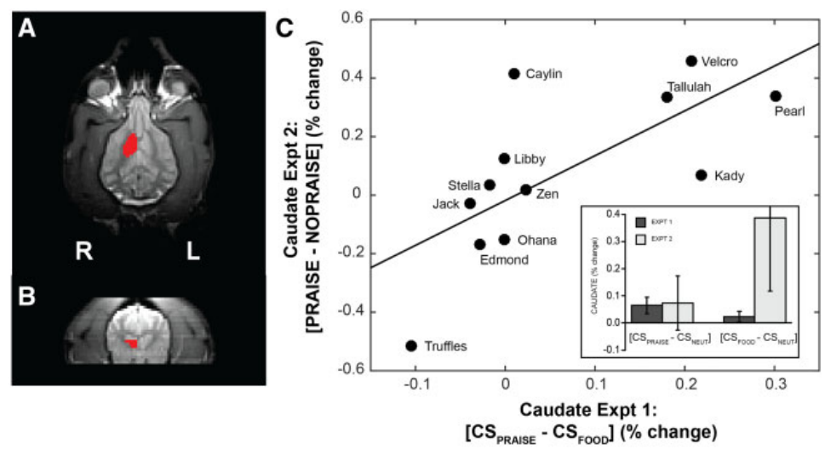
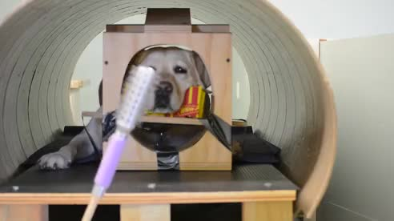
Dogs differ in social reward value
A study of non-cloned dogs compared responses to food and praise. The dogs had been trained to remain still during functional magnetic resonance imaging. Functional MRI measures blood-oxygen-related changes associated with local neural activity. The investigators examined responses in the caudate nucleus. This brain region participated in the study’s assessment of reward-related responses.
Signals predicting food and signals predicting praise elicited measurable responses. Individual dogs differed in their relative responses to the two rewards. Many responded as strongly or more strongly to praise. The same reward therefore did not have the same relative value for every dog. Neural measurement supplied an individual profile rather than a single species-wide preference.
The caudate observations were followed by behavioral choice tests. Dogs could approach food or their owner outside the scanner. Their choices were related to their earlier neural responses. This connected a brain measurement with behavior in another setting. Reward preference consequently became a measurable contributor to individual differences in training-related behavior.
Cook et al. (2016), Fig. 2. MRI-defined ventral caudate and reward-related responses in non-cloned dogs.
Cook (2016), scan-16-189-File006.mp4. Non-cloned-dog reward experiment.
Cook et al. (2016)
18
Notes:
• A study of non-cloned dogs compared responses to food and praise. The dogs had been trained to remain still during functional magnetic resonance imaging. **Functional MRI** measures blood-oxygen-related changes associated with local neural activity. The investigators examined responses in the caudate nucleus. This brain region participated in the study’s assessment of reward-related responses.
• Signals predicting food and signals predicting praise elicited measurable responses. Individual dogs differed in their relative responses to the two rewards. Many responded as strongly or more strongly to praise. The same reward therefore did not have the same relative value for every dog. Neural measurement supplied an individual profile rather than a single species-wide preference.
• The caudate observations were followed by behavioral choice tests. Dogs could approach food or their owner outside the scanner. Their choices were related to their earlier neural responses. This connected a brain measurement with behavior in another setting. Reward preference consequently became a measurable contributor to individual differences in training-related behavior.
References:
Cook PF, Prichard A, Spivak M, Berns GS (2016). Awake canine fMRI predicts dogs' preference for praise vs food. Social cognitive and affective neuroscience 11(12):1853-1862. https://doi.org/10.1093/scan/nsw102
Figure: Cook et al. (2016), Fig. 2. MRI-defined ventral caudate and reward-related responses in non-cloned dogs.
Figure source: https://doi.org/10.1093/scan/nsw102
Embedded video: Cook (2016), scan-16-189-File006.mp4. Non-cloned-dog reward experiment.
Article: Cook PF, Prichard A, Spivak M, Berns GS. (2016). Awake canine fMRI predicts dogs' preference for praise vs food. Social cognitive and affective neuroscience 11:1853-1862. https://doi.org/10.1093/scan/nsw102
Exact source filename: scan-16-189-File006.mp4
Original media/source page: https://www.ebi.ac.uk/europepmc/webservices/rest/PMC5141954/supplementaryFiles
Original source hash: 243ac017772cc838e229d2541dcbababcd785eb0f415607bafef2a543d7aff5e
Embedded clip hash: 638a437fcedced799909cd23abf9e4c1b1f03d44b63eecf9225718f67cde77ad
Source recording interval: 0.000–70.003 s. Original scientific frames, proportions, author-provided timing and available audio retained. Playback seconds are not necessarily biological elapsed time in source time-lapse/accelerated films.
License: This is an Open Access article distributed under the terms of the Creative Commons Attribution Non-Commercial License ( http://creativecommons.org/licenses/by-nc/4.0/ ), which permits non-commercial re-use, distribution, and reproduction in any medium, provided the original work is properly cited. For commercial re-use, please contact journals.permissions@oup.com
Native PPTX movie object with a separate static poster fallback. Desktop PowerPoint GUI playback and Google Slides import have not been tested. Google Slides may require inserting the supplied MP4 from Drive after import.

Slide 19
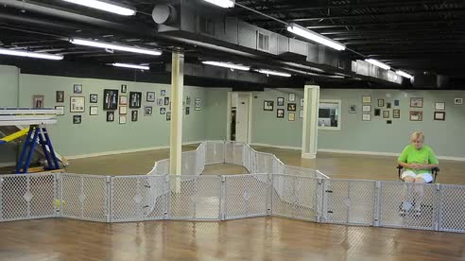
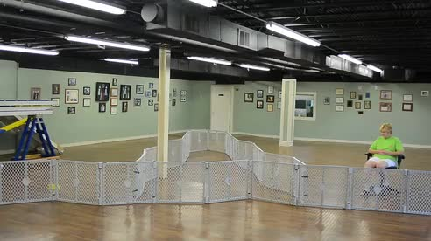
Caudate responses predict individual choices
The reward study tested whether individual preferences persisted across procedures. A signal predicting praise was compared with one predicting food. Another experiment withheld expected praise on some trials. This separated the response to an expectation from the response to the reward itself. The comparisons addressed related stages of reward processing.
The dogs then made repeated choices in a Y-maze. One option led to food and the other to the owner. Relative caudate responses predicted individual patterns of choice. Brain and behavioral measurements therefore described related differences among the dogs. The study did not depend on treating all dogs as equally food-motivated.
These were experienced, non-cloned companion dogs. Their results provide a separate comparison for interpreting working-animal performance. A reward operates through the animal’s own preferences and learned associations. Its effectiveness can therefore vary among individuals facing the same procedure. Training history and reward valuation remain part of the behavior being measured.
Cook et al. (2016), Fig. 2. MRI-defined ventral caudate and reward-related responses in non-cloned dogs.
Cook (2016), scan-16-189-File007.mp4. Non-cloned-dog reward experiment.
Cook (2016), scan-16-189-File008.mp4. Non-cloned-dog reward experiment.
Cook et al. (2016)
19
Notes:
• The reward study tested whether individual preferences persisted across procedures. A signal predicting praise was compared with one predicting food. Another experiment withheld expected praise on some trials. This separated the response to an expectation from the response to the reward itself. The comparisons addressed related stages of reward processing.
• The dogs then made repeated choices in a Y-maze. One option led to food and the other to the owner. Relative caudate responses predicted individual patterns of choice. Brain and behavioral measurements therefore described related differences among the dogs. The study did not depend on treating all dogs as equally food-motivated.
• These were experienced, non-cloned companion dogs. Their results provide a separate comparison for interpreting working-animal performance. A reward operates through the animal’s own preferences and learned associations. Its effectiveness can therefore vary among individuals facing the same procedure. Training history and reward valuation remain part of the behavior being measured.
References:
Cook PF, Prichard A, Spivak M, Berns GS (2016). Awake canine fMRI predicts dogs' preference for praise vs food. Social cognitive and affective neuroscience 11(12):1853-1862. https://doi.org/10.1093/scan/nsw102
Figure: Cook et al. (2016), Fig. 2. MRI-defined ventral caudate and reward-related responses in non-cloned dogs.
Figure source: https://doi.org/10.1093/scan/nsw102
Embedded video: Cook (2016), scan-16-189-File007.mp4. Non-cloned-dog reward experiment.
Article: Cook PF, Prichard A, Spivak M, Berns GS. (2016). Awake canine fMRI predicts dogs' preference for praise vs food. Social cognitive and affective neuroscience 11:1853-1862. https://doi.org/10.1093/scan/nsw102
Exact source filename: scan-16-189-File007.mp4
Original media/source page: https://www.ebi.ac.uk/europepmc/webservices/rest/PMC5141954/supplementaryFiles
Original source hash: bef8db5689bd5a1be5dece5dac4c451443d75ae4a39379eb6a9e5a606eac04c8
Embedded clip hash: 4b00478349f89a6a212358547e604460af177856a684284d0f1a35738dc2468f
Source recording interval: 0.000–15.015 s. Original scientific frames, proportions, author-provided timing and available audio retained. Playback seconds are not necessarily biological elapsed time in source time-lapse/accelerated films.
License: This is an Open Access article distributed under the terms of the Creative Commons Attribution Non-Commercial License ( http://creativecommons.org/licenses/by-nc/4.0/ ), which permits non-commercial re-use, distribution, and reproduction in any medium, provided the original work is properly cited. For commercial re-use, please contact journals.permissions@oup.com
Native PPTX movie object with a separate static poster fallback. Desktop PowerPoint GUI playback and Google Slides import have not been tested. Google Slides may require inserting the supplied MP4 from Drive after import.
Embedded video: Cook (2016), scan-16-189-File008.mp4. Non-cloned-dog reward experiment.
Article: Cook PF, Prichard A, Spivak M, Berns GS. (2016). Awake canine fMRI predicts dogs' preference for praise vs food. Social cognitive and affective neuroscience 11:1853-1862. https://doi.org/10.1093/scan/nsw102
Exact source filename: scan-16-189-File008.mp4
Original media/source page: https://www.ebi.ac.uk/europepmc/webservices/rest/PMC5141954/supplementaryFiles
Original source hash: 6f85e6e51687dcd5e5f3653b016e801a9545dd526726fe3524cd89d28ab66ecd
Embedded clip hash: a525b3232b5d3ab8d920ffe467881ae28cc0ac5ebe18c03533fc884a265d5cd1
Source recording interval: 0.000–10.010 s. Original scientific frames, proportions, author-provided timing and available audio retained. Playback seconds are not necessarily biological elapsed time in source time-lapse/accelerated films.
License: This is an Open Access article distributed under the terms of the Creative Commons Attribution Non-Commercial License ( http://creativecommons.org/licenses/by-nc/4.0/ ), which permits non-commercial re-use, distribution, and reproduction in any medium, provided the original work is properly cited. For commercial re-use, please contact journals.permissions@oup.com
Native PPTX movie object with a separate static poster fallback. Desktop PowerPoint GUI playback and Google Slides import have not been tested. Google Slides may require inserting the supplied MP4 from Drive after import.

Slide 20
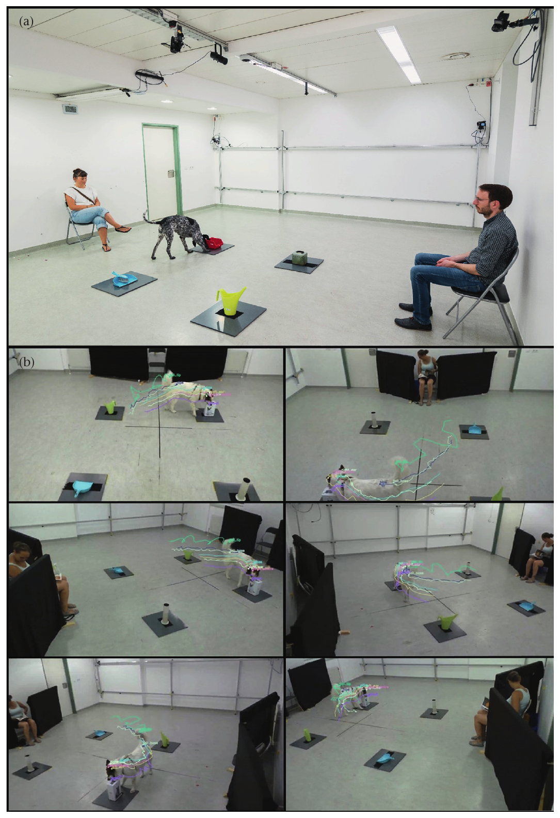
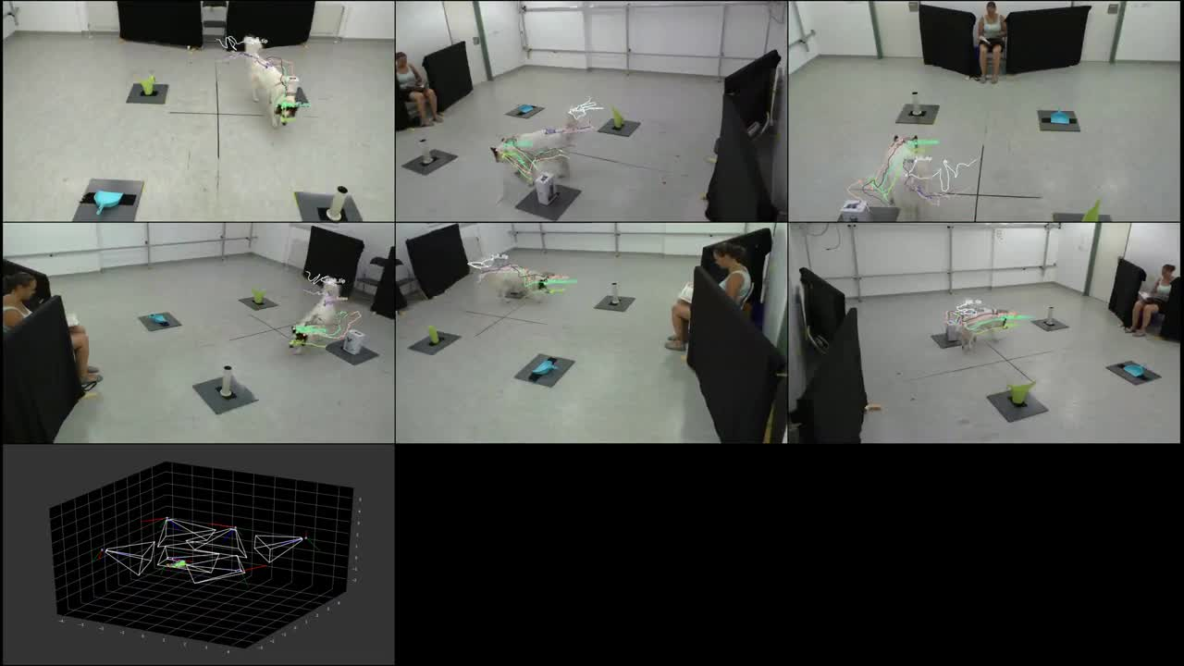
Caregiver presence changes exploration
Exploration occurs within a social context as well as a physical environment. A non-cloned-dog study compared exploration with and without the caregiver. The researchers recorded dogs interacting with objects in a test setting. Their analysis followed movement and investigation. Caregiver presence was therefore part of the experimental preparation rather than incidental background.
Video-based tracking quantified behavior across the test. A tracking system converts recorded positions into measured movement patterns. The study related those measurements to the caregiver condition. The same physical task could consequently be experienced within different social settings. Exploration was examined as behavior responsive to its current context.
A cloned animal also develops within relationships and routines. Nuclear matching does not standardize every later interaction. The caregiver experiment identifies one environmental variable that can be manipulated directly. Its recordings concern non-cloned dogs and retain that identity. The comparison explains how a social setting can enter the measurement of an individual’s behavior.
Völter et al. (2023), Fig. 1. Exploration setting and original tracking views in a caregiver-presence experiment.
Völter (2023), Video S1. Original caregiver/exploration tracking recording.
Völter et al. (2023)
20
Notes:
• Exploration occurs within a social context as well as a physical environment. A non-cloned-dog study compared exploration with and without the caregiver. The researchers recorded dogs interacting with objects in a test setting. Their analysis followed movement and investigation. Caregiver presence was therefore part of the experimental preparation rather than incidental background.
• Video-based tracking quantified behavior across the test. A tracking system converts recorded positions into measured movement patterns. The study related those measurements to the caregiver condition. The same physical task could consequently be experienced within different social settings. Exploration was examined as behavior responsive to its current context.
• A cloned animal also develops within relationships and routines. Nuclear matching does not standardize every later interaction. The caregiver experiment identifies one environmental variable that can be manipulated directly. Its recordings concern non-cloned dogs and retain that identity. The comparison explains how a social setting can enter the measurement of an individual’s behavior.
References:
Völter CJ, Starić D, Huber L (2023). Using machine learning to track dogs' exploratory behaviour in the presence and absence of their caregiver. Animal behaviour 197:97-111. https://doi.org/10.1016/j.anbehav.2023.01.004
Figure: Völter et al. (2023), Fig. 1. Exploration setting and original tracking views in a caregiver-presence experiment.
Figure source: https://doi.org/10.1016/j.anbehav.2023.01.004
Embedded video: Völter (2023), Video S1. Original caregiver/exploration tracking recording.
Article: Völter CJ, Starić D, Huber L. (2023). Using machine learning to track dogs' exploratory behaviour in the presence and absence of their caregiver. Animal behaviour 197:97-111. https://doi.org/10.1016/j.anbehav.2023.01.004
Exact source filename: EMS197405-supplement-Video_S1.mp4
Original media/source page: https://www.ebi.ac.uk/europepmc/webservices/rest/PMC7616271/supplementaryFiles
Original source hash: eedbabe593ca7676292d800c5d5ee5f9f03f05b3cee46440cc273318ebb12c94
Embedded clip hash: f822b3d759a2c0afc896fea22173f5d9c63ad05ec1061c5355f1ffa5bb8bec4e
Source recording interval: 0.000–30.697 s. Original scientific frames, proportions, author-provided timing and available audio retained. Playback seconds are not necessarily biological elapsed time in source time-lapse/accelerated films.
License: This is an open access article under the CC BY license ( https://creativecommons.org/licenses/by/4.0/ ).
Native PPTX movie object with a separate static poster fallback. Desktop PowerPoint GUI playback and Google Slides import have not been tested. Google Slides may require inserting the supplied MP4 from Drive after import.

Slide 21
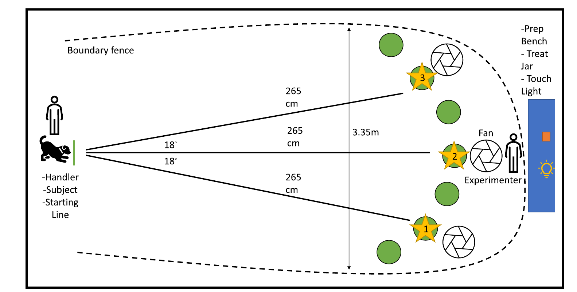
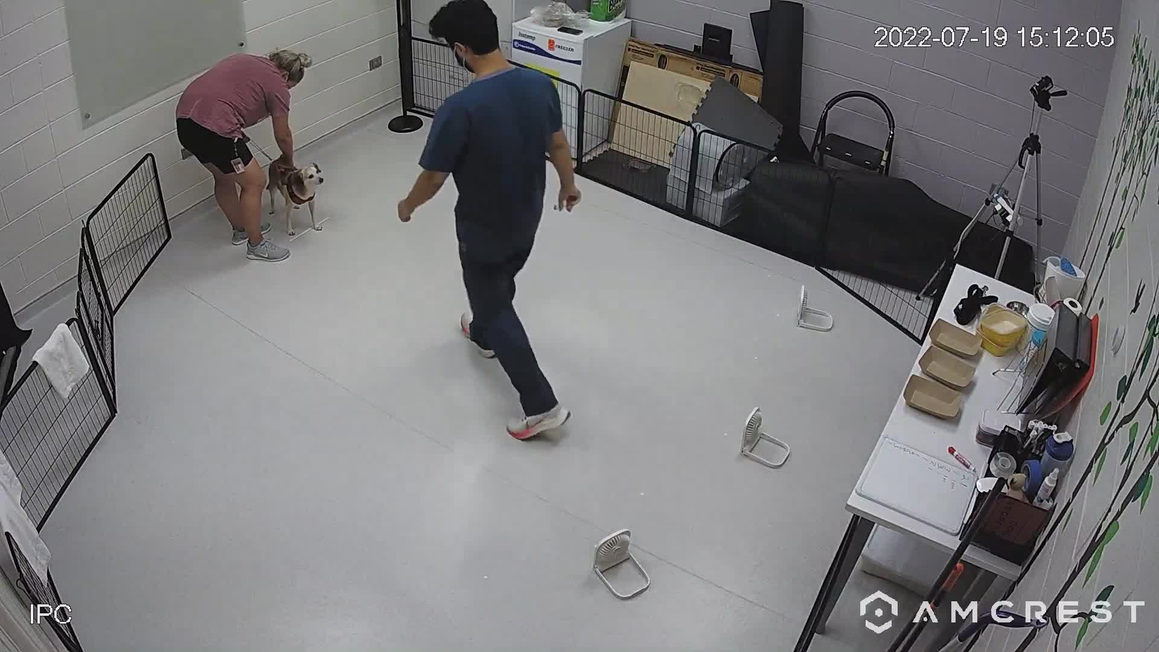
Lighting changes an odor-search task
A non-cloned-dog study used spontaneous searching to assess olfactory performance. Olfaction is the detection and processing of chemical information associated with smell. Dogs searched for food in a three-choice task. The procedure included light and dark conditions. Changing illumination altered the sensory information available during the same search problem.
Dogs performed more accurately in the dark condition. They were also less likely to use a biased choice strategy. Visual information and response habits could therefore affect an apparent odor task. The experimental comparison altered those opportunities directly. Accuracy described performance within a defined sensory preparation rather than smell considered in isolation.
A dog’s sensory behavior depends on the cues it actually uses. Removing one class of cues can change the contribution of another. The light–dark comparison exposed this interaction in searching. It also reduced the need for extensive prior training. The task provided a behavioral measure that could be compared across individual dogs and age groups.
Khan et al. (2023), Fig. 1. Three-choice odor-search preparation and light-path controls in non-cloned dogs.
Khan (2023), Supplementary Video 1. Original light/dark odor-search procedure, non-cloned dog.
Khan et al. (2023)
21
Notes:
• A non-cloned-dog study used spontaneous searching to assess olfactory performance. **Olfaction** is the detection and processing of chemical information associated with smell. Dogs searched for food in a three-choice task. The procedure included light and dark conditions. Changing illumination altered the sensory information available during the same search problem.
• Dogs performed more accurately in the dark condition. They were also less likely to use a biased choice strategy. Visual information and response habits could therefore affect an apparent odor task. The experimental comparison altered those opportunities directly. Accuracy described performance within a defined sensory preparation rather than smell considered in isolation.
• A dog’s sensory behavior depends on the cues it actually uses. Removing one class of cues can change the contribution of another. The light–dark comparison exposed this interaction in searching. It also reduced the need for extensive prior training. The task provided a behavioral measure that could be compared across individual dogs and age groups.
References:
Khan MZ, Mondino A, Russell K, Case B, Fefer G, Woods H, Olby N, Gruen M (2023). A novel task of canine olfaction for use in adult and senior pet dogs. Scientific reports 13(1):2224. https://doi.org/10.1038/s41598-023-29361-x
Figure: Khan et al. (2023), Fig. 1. Three-choice odor-search preparation and light-path controls in non-cloned dogs.
Figure source: https://doi.org/10.1038/s41598-023-29361-x
Embedded video: Khan (2023), Supplementary Video 1. Original light/dark odor-search procedure, non-cloned dog.
Article: Khan MZ, Mondino A, Russell K, Case B, Fefer G, Woods H, Olby N, Gruen M. (2023). A novel task of canine olfaction for use in adult and senior pet dogs. Scientific reports 13:2224. https://doi.org/10.1038/s41598-023-29361-x
Exact source filename: 41598_2023_29361_MOESM1_ESM.mp4
Original media/source page: https://www.ebi.ac.uk/europepmc/webservices/rest/PMC9908929/supplementaryFiles
Original source hash: 374e16a743bc4db7c11f620ef6cc33a03826f8735cb034013276cd7c9ec38c88
Embedded clip hash: c8e0a0d0209d28f13e813c3c053fc7657c627b8d5f285ceb3508d14e6870407d
Source recording interval: 0.000–92.600 s. Original scientific frames, proportions, author-provided timing and available audio retained. Playback seconds are not necessarily biological elapsed time in source time-lapse/accelerated films.
License: Open Access This article is licensed under a Creative Commons Attribution 4.0 International License, which permits use, sharing, adaptation, distribution and reproduction in any medium or format, as long as you give appropriate credit to the original author(s) and the source, provide a link to the Creative Commons licence, and indicate if changes were made. The images or other third party material in this article are included in the article's Creative Commons licence, unless indicated otherwise in a credit line to the material. If material is not included in the article's Creative Commons licence and your intended use is not permitted by statutory regulation or exceeds the permitted use, you will need to obtain permission directly from the copyright holder. To view a copy of this licence, visit http://creativecommons.org/licenses/by/4.0/ .
Native PPTX movie object with a separate static poster fallback. Desktop PowerPoint GUI playback and Google Slides import have not been tested. Google Slides may require inserting the supplied MP4 from Drive after import.

Slide 22
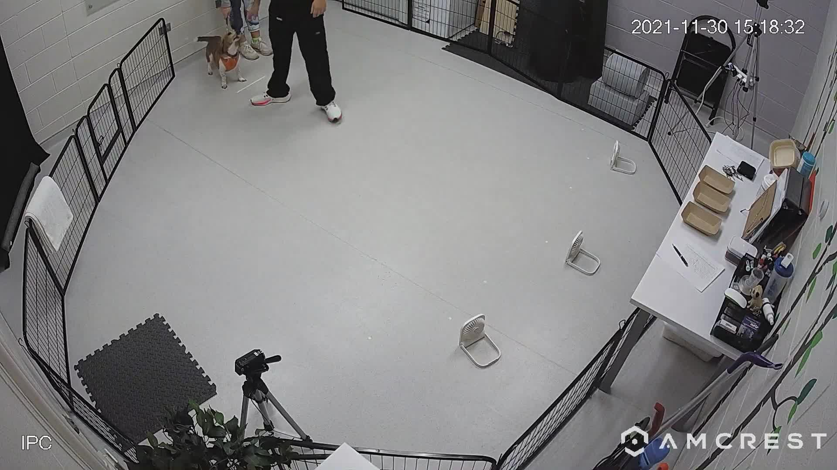
Age and strategy affect odor-search performance
The olfaction study compared adult dogs with senior and geriatric dogs. Geriatric refers to a late-life stage rather than a different genetic category. Older dogs performed above chance in the task. Their dark-condition accuracy was nevertheless lower than that of the adult controls. The measured difference therefore concerned performance within a particular preparation.
The investigators also examined choice biases. A dog can favor a location without using the relevant odor information consistently. That strategy affects the interpretation of correct and incorrect responses. The task therefore included clearly defined behavioral endpoints. Sensory ability and the strategy used to solve the task were assessed together.
Age was measured in the animals’ own lives. The comparison does not involve nuclear donor age or cloned animals. It provides a separate example of how developmental history enters behavioral assessment. An identical task can place different demands on individuals. Interpreting performance requires the preparation, sensory conditions and response strategy to remain explicit.
Khan et al. (2023), Fig. 1. Three-choice odor-search preparation and light-path controls in non-cloned dogs.
Khan (2023), Supplementary Video 2. Original light/dark odor-search procedure, non-cloned dog.
Khan et al. (2023)
22
Notes:
• The olfaction study compared adult dogs with senior and geriatric dogs. **Geriatric** refers to a late-life stage rather than a different genetic category. Older dogs performed above chance in the task. Their dark-condition accuracy was nevertheless lower than that of the adult controls. The measured difference therefore concerned performance within a particular preparation.
• The investigators also examined choice biases. A dog can favor a location without using the relevant odor information consistently. That strategy affects the interpretation of correct and incorrect responses. The task therefore included clearly defined behavioral endpoints. Sensory ability and the strategy used to solve the task were assessed together.
• Age was measured in the animals’ own lives. The comparison does not involve nuclear donor age or cloned animals. It provides a separate example of how developmental history enters behavioral assessment. An identical task can place different demands on individuals. Interpreting performance requires the preparation, sensory conditions and response strategy to remain explicit.
References:
Khan MZ, Mondino A, Russell K, Case B, Fefer G, Woods H, Olby N, Gruen M (2023). A novel task of canine olfaction for use in adult and senior pet dogs. Scientific reports 13(1):2224. https://doi.org/10.1038/s41598-023-29361-x
Figure: Khan et al. (2023), Fig. 1. Three-choice odor-search preparation and light-path controls in non-cloned dogs.
Figure source: https://doi.org/10.1038/s41598-023-29361-x
Embedded video: Khan (2023), Supplementary Video 2. Original light/dark odor-search procedure, non-cloned dog.
Article: Khan MZ, Mondino A, Russell K, Case B, Fefer G, Woods H, Olby N, Gruen M. (2023). A novel task of canine olfaction for use in adult and senior pet dogs. Scientific reports 13:2224. https://doi.org/10.1038/s41598-023-29361-x
Exact source filename: 41598_2023_29361_MOESM2_ESM.mp4
Original media/source page: https://www.ebi.ac.uk/europepmc/webservices/rest/PMC9908929/supplementaryFiles
Original source hash: e7e67a292400ae75425cb5858f101feeedc1b063ed9f06fa2f90d103c8b6c180
Embedded clip hash: 92d557758f7863cebc7335fc28f2c0fa560cc829bfc38c98cfa888df964914e7
Source recording interval: 0.000–62.133 s. Original scientific frames, proportions, author-provided timing and available audio retained. Playback seconds are not necessarily biological elapsed time in source time-lapse/accelerated films.
License: Open Access This article is licensed under a Creative Commons Attribution 4.0 International License, which permits use, sharing, adaptation, distribution and reproduction in any medium or format, as long as you give appropriate credit to the original author(s) and the source, provide a link to the Creative Commons licence, and indicate if changes were made. The images or other third party material in this article are included in the article's Creative Commons licence, unless indicated otherwise in a credit line to the material. If material is not included in the article's Creative Commons licence and your intended use is not permitted by statutory regulation or exceeds the permitted use, you will need to obtain permission directly from the copyright holder. To view a copy of this licence, visit http://creativecommons.org/licenses/by/4.0/ .
Native PPTX movie object with a separate static poster fallback. Desktop PowerPoint GUI playback and Google Slides import have not been tested. Google Slides may require inserting the supplied MP4 from Drive after import.

Slide 23
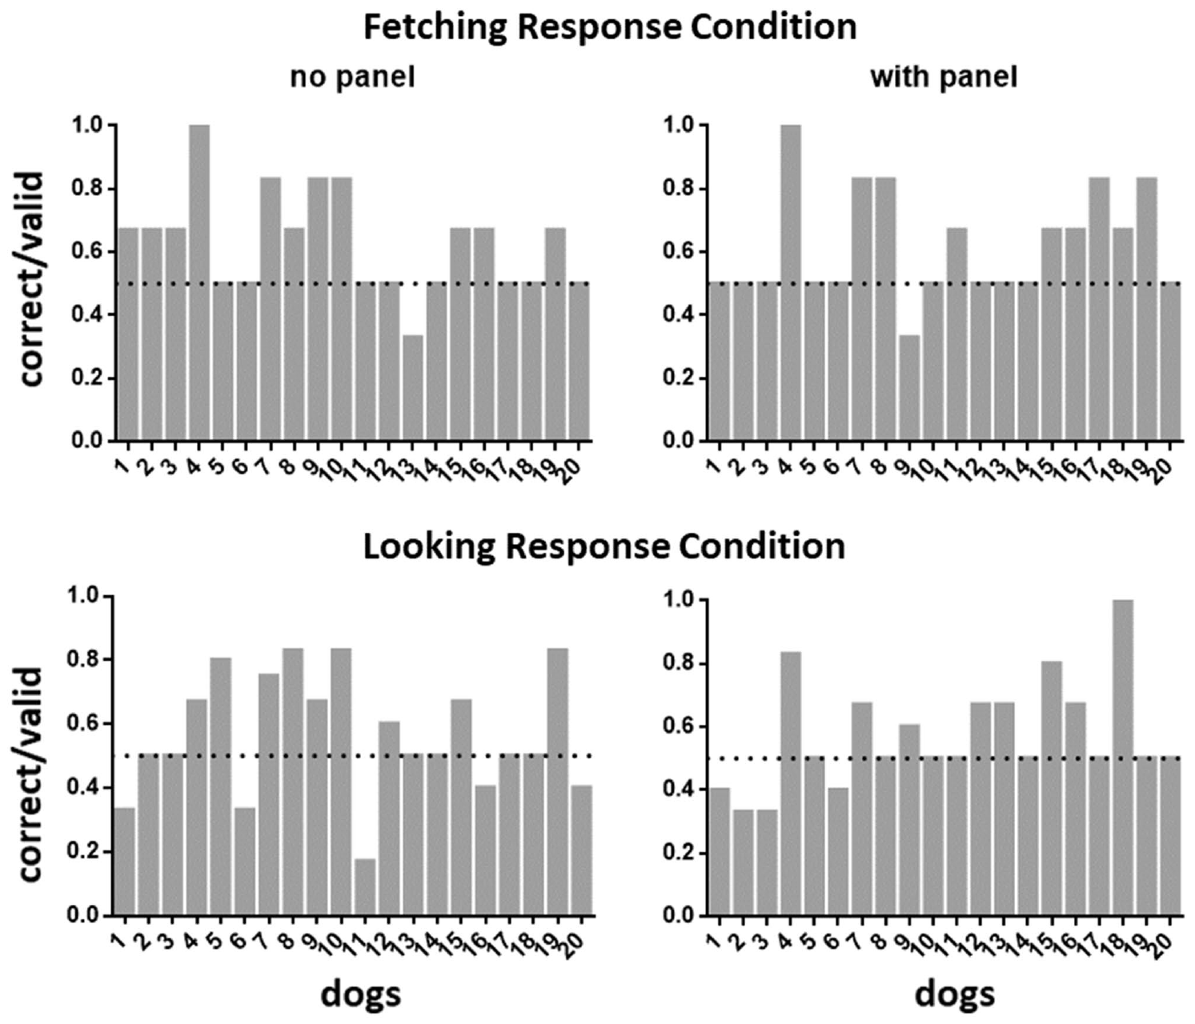
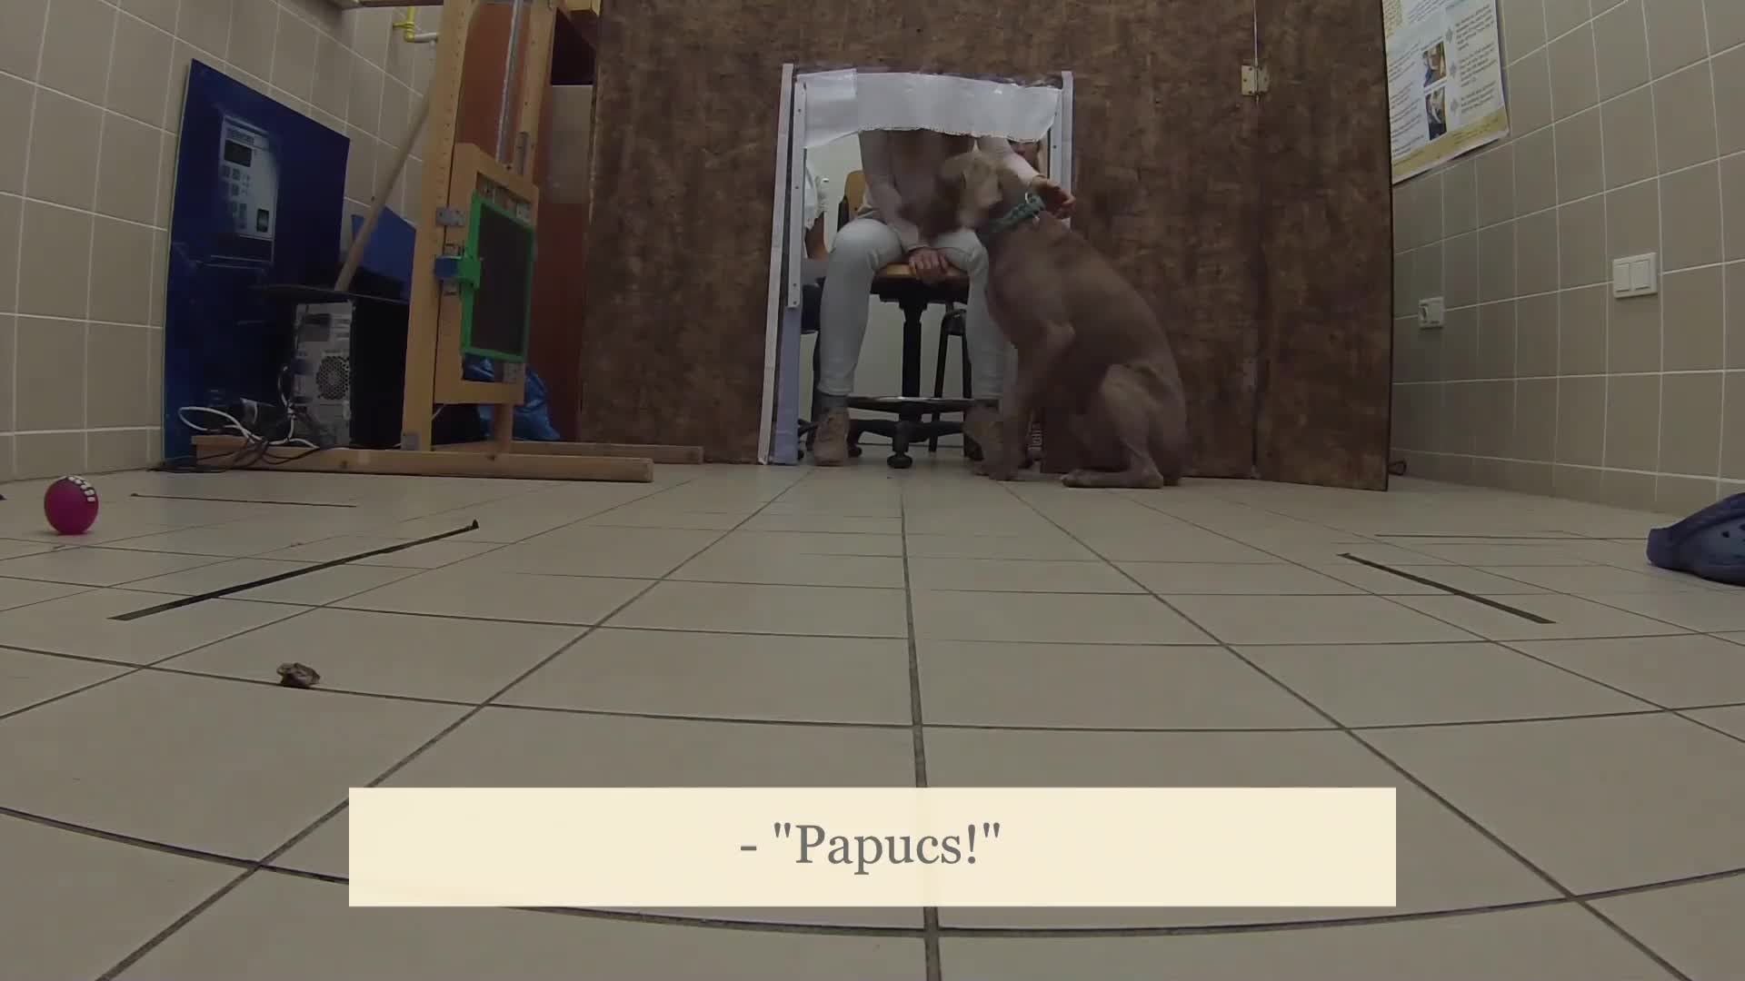
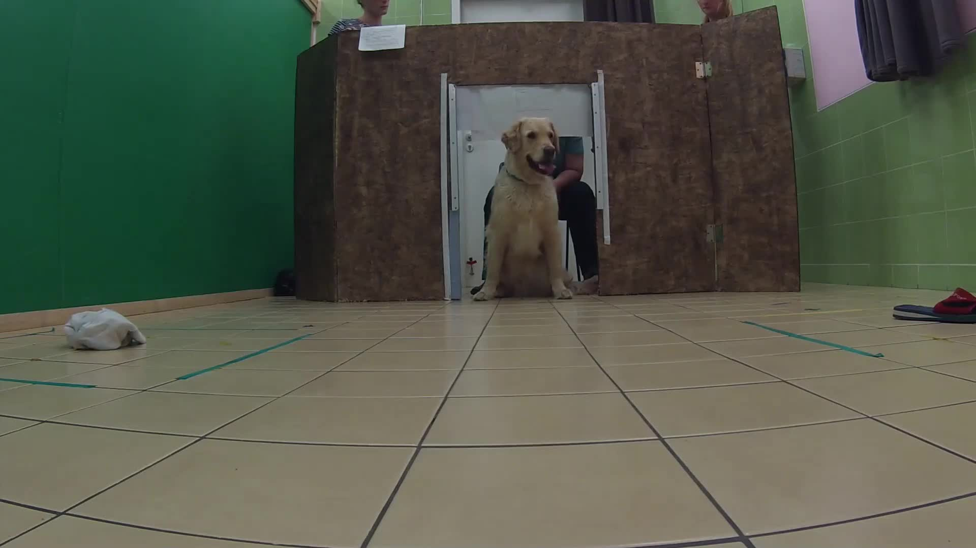
Object labels compete with other cues
A non-cloned-dog study examined responses to spoken object labels. Object-label learning links a spoken cue with a particular object. The researchers recorded looking and object-directed responses. They also considered non-verbal information supplied by owners. The preparation separated several possible sources of a successful-looking response.
Dogs did not all display the rapid, stable label mapping associated with exceptional word-learning animals. Group-level responses were more variable. Looking at an object and fetching it also supplied different measurements. The study therefore treated performance as a set of behaviors. A single correct retrieval was not a complete description of the underlying learning process.
The authors proposed contextual learning as one hypothesis for the observed pattern. A learned response can depend on the surrounding situation as well as the spoken word. Controls for non-verbal cues address that possibility experimentally. The original recordings preserve the actual task and responses. This comparison connects individual learning performance with the information available during testing.
Kőszegi et al. (2023), Fig. 2. Individual looking and fetching responses in an object-label task.
Kőszegi (2023), Supplementary Video 1. Original object-label trial, non-cloned dog.
Kőszegi (2023), Supplementary Video 2. Original object-label trial, non-cloned dog.
Kőszegi et al. (2023)
23
Notes:
• A non-cloned-dog study examined responses to spoken object labels. **Object-label learning** links a spoken cue with a particular object. The researchers recorded looking and object-directed responses. They also considered non-verbal information supplied by owners. The preparation separated several possible sources of a successful-looking response.
• Dogs did not all display the rapid, stable label mapping associated with exceptional word-learning animals. Group-level responses were more variable. Looking at an object and fetching it also supplied different measurements. The study therefore treated performance as a set of behaviors. A single correct retrieval was not a complete description of the underlying learning process.
• The authors proposed contextual learning as one hypothesis for the observed pattern. A learned response can depend on the surrounding situation as well as the spoken word. Controls for non-verbal cues address that possibility experimentally. The original recordings preserve the actual task and responses. This comparison connects individual learning performance with the information available during testing.
References:
Kőszegi H, Fugazza C, Magyari L, Iotchev IB, Miklósi Á, Andics A (2023). Investigating responses to object-labels in the domestic dog (Canis familiaris). Scientific reports 13(1):3150. https://doi.org/10.1038/s41598-023-30201-1
Figure: Kőszegi et al. (2023), Fig. 2. Individual looking and fetching responses in an object-label task.
Figure source: https://doi.org/10.1038/s41598-023-30201-1
Embedded video: Kőszegi (2023), Supplementary Video 1. Original object-label trial, non-cloned dog.
Article: Kőszegi H, Fugazza C, Magyari L, Iotchev IB, Miklósi Á, Andics A. (2023). Investigating responses to object-labels in the domestic dog (Canis familiaris). Scientific reports 13:3150. https://doi.org/10.1038/s41598-023-30201-1
Exact source filename: 41598_2023_30201_MOESM3_ESM.mp4
Original media/source page: https://www.ebi.ac.uk/europepmc/webservices/rest/PMC9950079/supplementaryFiles
Original source hash: fc9fc0ad4467ba98f5871a8dce61d4ec625ade75eac2e16d9a1cd7d734eb7f0e
Embedded clip hash: 86187dab74dc837c71c6713840b350bd2347476d0504838dc3696406ee24f117
Source recording interval: 0.000–6.421 s. Original scientific frames, proportions, author-provided timing and available audio retained. Playback seconds are not necessarily biological elapsed time in source time-lapse/accelerated films.
License: Open Access This article is licensed under a Creative Commons Attribution 4.0 International License, which permits use, sharing, adaptation, distribution and reproduction in any medium or format, as long as you give appropriate credit to the original author(s) and the source, provide a link to the Creative Commons licence, and indicate if changes were made. The images or other third party material in this article are included in the article's Creative Commons licence, unless indicated otherwise in a credit line to the material. If material is not included in the article's Creative Commons licence and your intended use is not permitted by statutory regulation or exceeds the permitted use, you will need to obtain permission directly from the copyright holder. To view a copy of this licence, visit http://creativecommons.org/licenses/by/4.0/ .
Native PPTX movie object with a separate static poster fallback. Desktop PowerPoint GUI playback and Google Slides import have not been tested. Google Slides may require inserting the supplied MP4 from Drive after import.
Embedded video: Kőszegi (2023), Supplementary Video 2. Original object-label trial, non-cloned dog.
Article: Kőszegi H, Fugazza C, Magyari L, Iotchev IB, Miklósi Á, Andics A. (2023). Investigating responses to object-labels in the domestic dog (Canis familiaris). Scientific reports 13:3150. https://doi.org/10.1038/s41598-023-30201-1
Exact source filename: 41598_2023_30201_MOESM4_ESM.mp4
Original media/source page: https://www.ebi.ac.uk/europepmc/webservices/rest/PMC9950079/supplementaryFiles
Original source hash: 0cbcb10a01b57a112cd20e8a95a221802e2033f325bd17cfe06b5d270242acd4
Embedded clip hash: 9b658dac7ff13f729a44e0bc973becbcb47ed1762f9f3253fbd87c5ad03285d8
Source recording interval: 0.000–4.096 s. Original scientific frames, proportions, author-provided timing and available audio retained. Playback seconds are not necessarily biological elapsed time in source time-lapse/accelerated films.
License: Open Access This article is licensed under a Creative Commons Attribution 4.0 International License, which permits use, sharing, adaptation, distribution and reproduction in any medium or format, as long as you give appropriate credit to the original author(s) and the source, provide a link to the Creative Commons licence, and indicate if changes were made. The images or other third party material in this article are included in the article's Creative Commons licence, unless indicated otherwise in a credit line to the material. If material is not included in the article's Creative Commons licence and your intended use is not permitted by statutory regulation or exceeds the permitted use, you will need to obtain permission directly from the copyright holder. To view a copy of this licence, visit http://creativecommons.org/licenses/by/4.0/ .
Native PPTX movie object with a separate static poster fallback. Desktop PowerPoint GUI playback and Google Slides import have not been tested. Google Slides may require inserting the supplied MP4 from Drive after import.

Slide 24
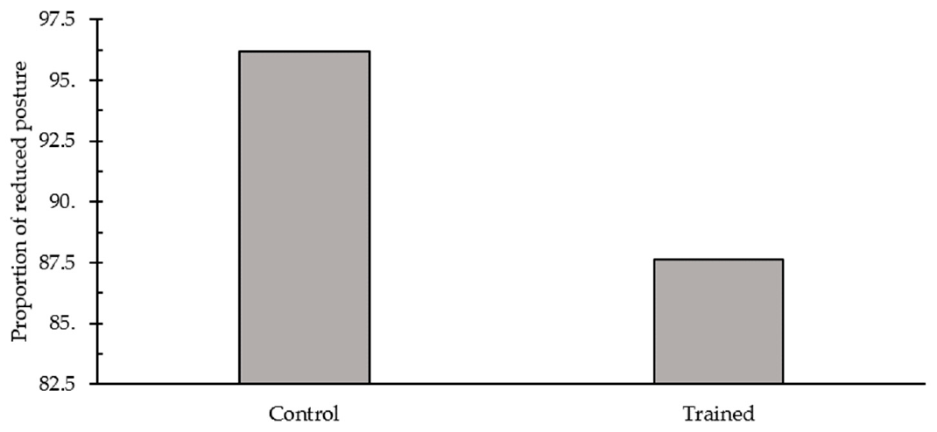
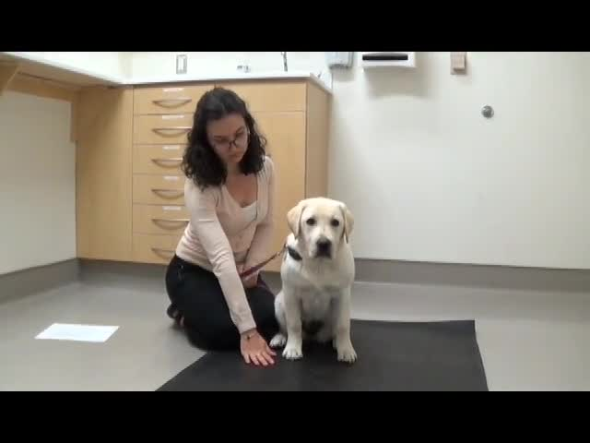
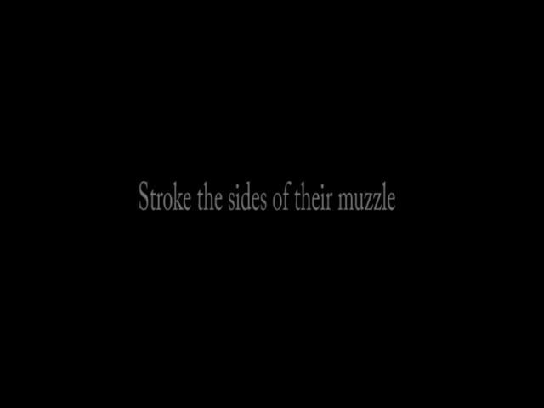
Handling experience can change fear responses
A study of non-cloned companion dogs tested a four-week training program for veterinary fear. Owners practiced examination-style handling and made clinic visits. Desensitization exposes an animal to manageable versions of a feared stimulus. Counter-conditioning pairs that stimulus with a different, typically positive outcome. The preparation manipulated experience rather than nuclear genotype.
The program produced modest improvements in some behavioral fear measures. It did not change every physiological or behavioral measure examined. For example, several physiological responses remained unaffected by the training program. The outcome therefore differed across components of the fear response. This distinction prevents a limited training effect from being described as complete removal of fear.
The article-provided handling recording documents the procedures owners were instructed to practice. Different parts of an examination impose different sensory and physical events. Gradual handling changes the animal’s exposure to those events. Reward pairing changes the association accompanying that exposure. The procedure connects learning history with behavior during later examination.
Stellato et al. (2019), Fig. 3. Posture during examination after a handling and counter-conditioning program.
Stellato (2019), Handling Progressions, paw segment. Paw handling and food pairing.
Stellato (2019), Handling Progressions, muzzle segment. Muzzle and lip handling.
Stellato et al. (2019)
24
Notes:
• A study of non-cloned companion dogs tested a four-week training program for veterinary fear. Owners practiced examination-style handling and made clinic visits. **Desensitization** exposes an animal to manageable versions of a feared stimulus. **Counter-conditioning** pairs that stimulus with a different, typically positive outcome. The preparation manipulated experience rather than nuclear genotype.
• The program produced modest improvements in some behavioral fear measures. It did not change every physiological or behavioral measure examined. For example, several physiological responses remained unaffected by the training program. The outcome therefore differed across components of the fear response. This distinction prevents a limited training effect from being described as complete removal of fear.
• The article-provided handling recording documents the procedures owners were instructed to practice. Different parts of an examination impose different sensory and physical events. Gradual handling changes the animal’s exposure to those events. Reward pairing changes the association accompanying that exposure. The procedure connects learning history with behavior during later examination.
References:
Stellato A, Jajou S, Dewey CE, Widowski TM, Niel L (2019). Effect of a Standardized Four-Week Desensitization and Counter-Conditioning Training Program on Pre-Existing Veterinary Fear in Companion Dogs. Animals : an open access journal from MDPI 9(10):E767. https://doi.org/10.3390/ani9100767
Figure: Stellato et al. (2019), Fig. 3. Posture during examination after a handling and counter-conditioning program.
Figure source: https://doi.org/10.3390/ani9100767
Embedded video: Stellato (2019), Handling Progressions, paw segment. Paw handling and food pairing.
Article: Stellato A, Jajou S, Dewey CE, Widowski TM, Niel L. (2019). Effect of a Standardized Four-Week Desensitization and Counter-Conditioning Training Program on Pre-Existing Veterinary Fear in Companion Dogs. Animals : an open access journal from MDPI 9:E767. https://doi.org/10.3390/ani9100767
Exact source filename: DogFearTraining_HandlingProgressions.mp4
Original media/source page: https://vimeo.com/276290339/9d5d0f6a3d
Original source hash: 6e8d39a6e32ee7764c814abb7df7b7f25e2dd378691b1e85e151828cacf40c4c
Embedded clip hash: 103a865b0ad803cbf98af19447c0597fc3d36dc0d7b60adc10458b0021cb95f5
Source recording interval: 12.000–74.000 s. Original scientific frames, proportions, author-provided timing and available audio retained. Playback seconds are not necessarily biological elapsed time in source time-lapse/accelerated films.
License: Licensee MDPI, Basel, Switzerland. This article is an open access article distributed under the terms and conditions of the Creative Commons Attribution (CC BY) license ( http://creativecommons.org/licenses/by/4.0/ ).
Native PPTX movie object with a separate static poster fallback. Desktop PowerPoint GUI playback and Google Slides import have not been tested. Google Slides may require inserting the supplied MP4 from Drive after import.
Embedded video: Stellato (2019), Handling Progressions, muzzle segment. Muzzle and lip handling.
Article: Stellato A, Jajou S, Dewey CE, Widowski TM, Niel L. (2019). Effect of a Standardized Four-Week Desensitization and Counter-Conditioning Training Program on Pre-Existing Veterinary Fear in Companion Dogs. Animals : an open access journal from MDPI 9:E767. https://doi.org/10.3390/ani9100767
Exact source filename: DogFearTraining_HandlingProgressions.mp4
Original media/source page: https://vimeo.com/276290339/9d5d0f6a3d
Original source hash: 6e8d39a6e32ee7764c814abb7df7b7f25e2dd378691b1e85e151828cacf40c4c
Embedded clip hash: b46db9cc0b1e58d597adff65737cfe0749462473c32b9a0ce7b5bd2a5244c892
Source recording interval: 80.000–139.000 s. Original scientific frames, proportions, author-provided timing and available audio retained. Playback seconds are not necessarily biological elapsed time in source time-lapse/accelerated films.
License: Licensee MDPI, Basel, Switzerland. This article is an open access article distributed under the terms and conditions of the Creative Commons Attribution (CC BY) license ( http://creativecommons.org/licenses/by/4.0/ ).
Native PPTX movie object with a separate static poster fallback. Desktop PowerPoint GUI playback and Google Slides import have not been tested. Google Slides may require inserting the supplied MP4 from Drive after import.

Slide 25
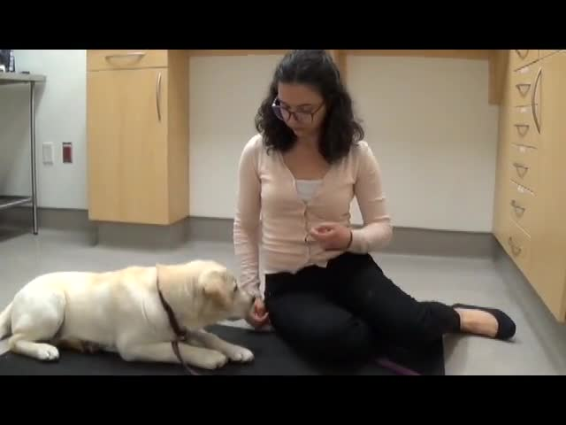
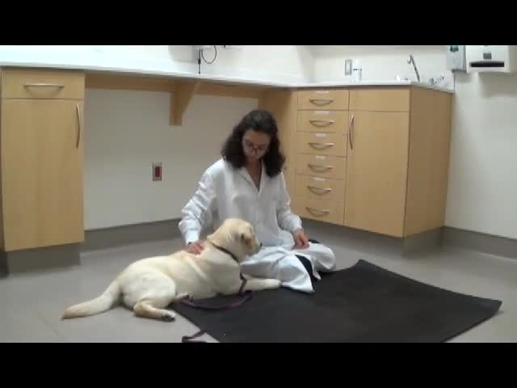
Training delivery and outcomes need assessment
A standardized instruction does not guarantee identical training experience. In the veterinary-fear study, some owners did not complete the prescribed program. The investigators also used an observer unaware of group assignment for fear assessment. Blinding reduces the opportunity for knowledge of treatment to influence scoring. The preparation therefore addressed both intervention delivery and behavioral measurement.
Fear was assessed during clinic arrival and examination. These situations expose the dog to different combinations of stimuli. Posture, avoidance and physiological responses also describe different components of its response. The study’s modest benefit was consequently evaluated across several observations. Improvement in one observation did not imply that all response systems changed together.
The handling progression supplies a reproducible description of the intended experience. The outcome tests what changed after that experience. These are distinct parts of an intervention study. Their separation is relevant when comparing animals with different developmental histories. A dog’s response is measured after its actual experiences, including the training it received.
Stellato et al. (2019), Fig. 3. Posture during examination after a handling and counter-conditioning program.
Stellato (2019), Handling Progressions, head/ear segment. Head and ear handling.
Stellato (2019), Handling Progressions, body segment. Back, chest and body handling.
Stellato et al. (2019)
25
Notes:
• A standardized instruction does not guarantee identical training experience. In the veterinary-fear study, some owners did not complete the prescribed program. The investigators also used an observer unaware of group assignment for fear assessment. **Blinding** reduces the opportunity for knowledge of treatment to influence scoring. The preparation therefore addressed both intervention delivery and behavioral measurement.
• Fear was assessed during clinic arrival and examination. These situations expose the dog to different combinations of stimuli. Posture, avoidance and physiological responses also describe different components of its response. The study’s modest benefit was consequently evaluated across several observations. Improvement in one observation did not imply that all response systems changed together.
• The handling progression supplies a reproducible description of the intended experience. The outcome tests what changed after that experience. These are distinct parts of an intervention study. Their separation is relevant when comparing animals with different developmental histories. A dog’s response is measured after its actual experiences, including the training it received.
References:
Stellato A, Jajou S, Dewey CE, Widowski TM, Niel L (2019). Effect of a Standardized Four-Week Desensitization and Counter-Conditioning Training Program on Pre-Existing Veterinary Fear in Companion Dogs. Animals : an open access journal from MDPI 9(10):E767. https://doi.org/10.3390/ani9100767
Figure: Stellato et al. (2019), Fig. 3. Posture during examination after a handling and counter-conditioning program.
Figure source: https://doi.org/10.3390/ani9100767
Embedded video: Stellato (2019), Handling Progressions, head/ear segment. Head and ear handling.
Article: Stellato A, Jajou S, Dewey CE, Widowski TM, Niel L. (2019). Effect of a Standardized Four-Week Desensitization and Counter-Conditioning Training Program on Pre-Existing Veterinary Fear in Companion Dogs. Animals : an open access journal from MDPI 9:E767. https://doi.org/10.3390/ani9100767
Exact source filename: DogFearTraining_HandlingProgressions.mp4
Original media/source page: https://vimeo.com/276290339/9d5d0f6a3d
Original source hash: 6e8d39a6e32ee7764c814abb7df7b7f25e2dd378691b1e85e151828cacf40c4c
Embedded clip hash: 5d48fc39e4ad14b306d337025c24c926bd360044cd3a068f8f21305f78474014
Source recording interval: 140.000–199.000 s. Original scientific frames, proportions, author-provided timing and available audio retained. Playback seconds are not necessarily biological elapsed time in source time-lapse/accelerated films.
License: Licensee MDPI, Basel, Switzerland. This article is an open access article distributed under the terms and conditions of the Creative Commons Attribution (CC BY) license ( http://creativecommons.org/licenses/by/4.0/ ).
Native PPTX movie object with a separate static poster fallback. Desktop PowerPoint GUI playback and Google Slides import have not been tested. Google Slides may require inserting the supplied MP4 from Drive after import.
Embedded video: Stellato (2019), Handling Progressions, body segment. Back, chest and body handling.
Article: Stellato A, Jajou S, Dewey CE, Widowski TM, Niel L. (2019). Effect of a Standardized Four-Week Desensitization and Counter-Conditioning Training Program on Pre-Existing Veterinary Fear in Companion Dogs. Animals : an open access journal from MDPI 9:E767. https://doi.org/10.3390/ani9100767
Exact source filename: DogFearTraining_HandlingProgressions.mp4
Original media/source page: https://vimeo.com/276290339/9d5d0f6a3d
Original source hash: 6e8d39a6e32ee7764c814abb7df7b7f25e2dd378691b1e85e151828cacf40c4c
Embedded clip hash: a256571b19016f5814236222d20f6087d2e15c0cda47323881e2e1de946cd43a
Source recording interval: 200.000–245.000 s. Original scientific frames, proportions, author-provided timing and available audio retained. Playback seconds are not necessarily biological elapsed time in source time-lapse/accelerated films.
License: Licensee MDPI, Basel, Switzerland. This article is an open access article distributed under the terms and conditions of the Creative Commons Attribution (CC BY) license ( http://creativecommons.org/licenses/by/4.0/ ).
Native PPTX movie object with a separate static poster fallback. Desktop PowerPoint GUI playback and Google Slides import have not been tested. Google Slides may require inserting the supplied MP4 from Drive after import.

Slide 26
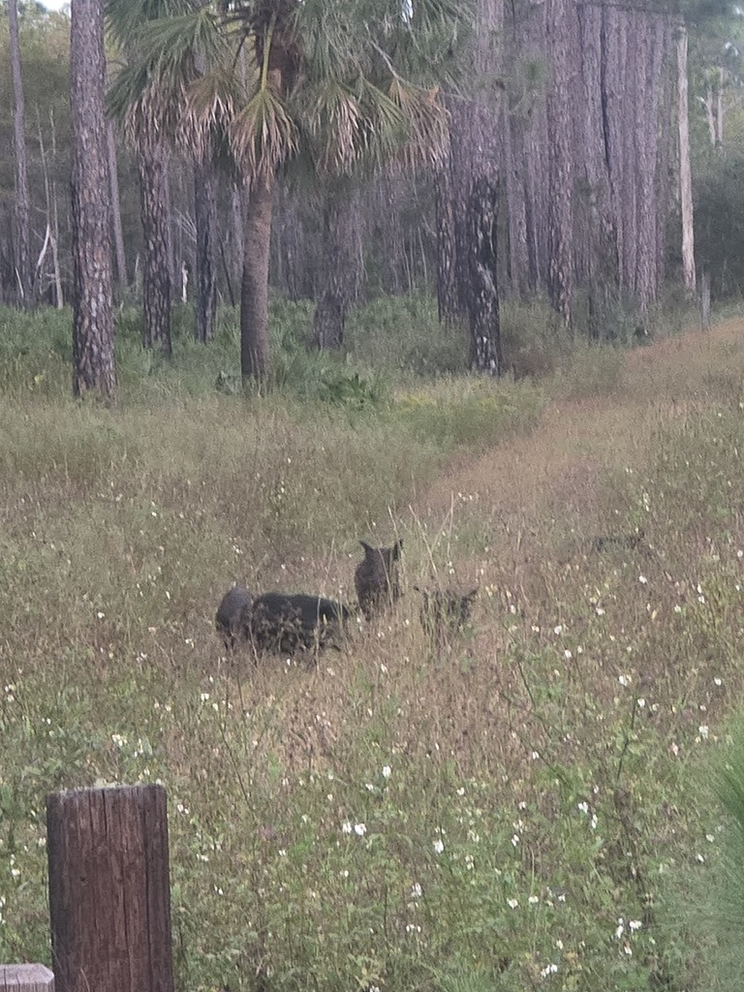
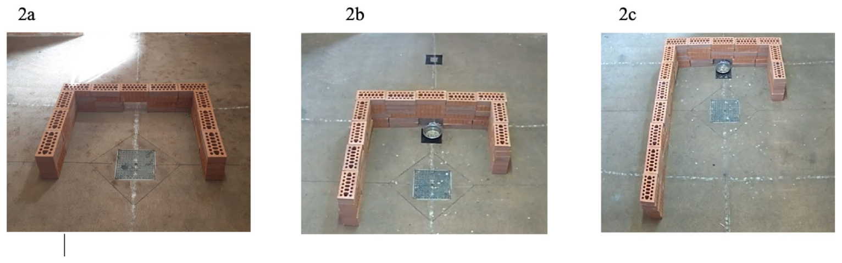
Cloned pigs can solve a detour problem
A detour requires an animal to reach a goal by moving around an obstacle. The minipig study compared animals from several clone families. A food bowl provided the goal. A low barrier interrupted the direct route. The task therefore examined how the pigs moved around a visible obstruction to obtain food.
The animals were familiarized with the testing environment and trained before the experiment. The study then measured their routes through the barrier arrangement. Entry and exit choices described how they approached the problem. Different observations could be compared across repeated trials. Shared clone-family origin was assessed against actual navigation behavior.
A clone family contains animals derived from a common donor source. Families can differ genetically from one another while containing closely matched individuals. The study used this structure to compare performance. Individual routes still had to be recorded rather than assumed from family identity. The task connected nuclear relatedness with a measurable acquired behavior.
Paganelli et al. (2023), Fig. 2(a–c). Symmetric and asymmetric barriers in the cloned-minipig detour task.
Photo: Sus scrofa. Scott Allen Davis. CC BY 4.0.
Paganelli et al. (2023)
26
Notes:
• A detour requires an animal to reach a goal by moving around an obstacle. The minipig study compared animals from several clone families. A food bowl provided the goal. A low barrier interrupted the direct route. The task therefore examined how the pigs moved around a visible obstruction to obtain food.
• The animals were familiarized with the testing environment and trained before the experiment. The study then measured their routes through the barrier arrangement. Entry and exit choices described how they approached the problem. Different observations could be compared across repeated trials. Shared clone-family origin was assessed against actual navigation behavior.
• A **clone family** contains animals derived from a common donor source. Families can differ genetically from one another while containing closely matched individuals. The study used this structure to compare performance. Individual routes still had to be recorded rather than assumed from family identity. The task connected nuclear relatedness with a measurable acquired behavior.
References:
Paganelli A, Felici M, Turini L, Baragli P, Carlucci L, Recchia FA, Sgorbini M (2023). Detour test performance of cloned minipigs from three different clone populations. Veterinary research communications 47(4):2137-2144. https://doi.org/10.1007/s11259-023-10168-0
Figure: Paganelli et al. (2023), Fig. 2(a–c). Symmetric and asymmetric barriers in the cloned-minipig detour task.
Figure source: https://doi.org/10.1007/s11259-023-10168-0
Image: Photo: Sus scrofa. Credit: (c) Scott Allen Davis, some rights reserved (CC BY). License: CC BY 4.0. Source: https://www.inaturalist.org/observations/409782835

Slide 27
Barrier asymmetry changes available routes
The detour study used symmetric and asymmetric barriers. A symmetric barrier provides corresponding routes of equal extent. An asymmetric barrier makes the alternatives unequal. The investigators changed the arrangement of the same basic obstacle. The pig therefore encountered a changed spatial problem rather than an entirely different reward.
The asymmetric configurations differed in the lengths of their arms. This changed the distance associated with entering from either side. Route selection could consequently be examined under different spatial constraints. The task also preserved the food goal. Changes in performance could be interpreted within that controlled physical arrangement.
An established response can persist when the environment changes. Repeated trials expose the relationship between a familiar route and the current barrier. The study recorded both entry and exit behavior. These observations distinguished parts of the detour sequence. They connected the animal’s previous choices with its response to the present physical configuration.
Paganelli et al. (2023), Fig. 2(a–c). Symmetric and asymmetric barriers in the cloned-minipig detour task.
Paganelli et al. (2023)
27
Notes:
• The detour study used symmetric and asymmetric barriers. A **symmetric** barrier provides corresponding routes of equal extent. An **asymmetric** barrier makes the alternatives unequal. The investigators changed the arrangement of the same basic obstacle. The pig therefore encountered a changed spatial problem rather than an entirely different reward.
• The asymmetric configurations differed in the lengths of their arms. This changed the distance associated with entering from either side. Route selection could consequently be examined under different spatial constraints. The task also preserved the food goal. Changes in performance could be interpreted within that controlled physical arrangement.
• An established response can persist when the environment changes. Repeated trials expose the relationship between a familiar route and the current barrier. The study recorded both entry and exit behavior. These observations distinguished parts of the detour sequence. They connected the animal’s previous choices with its response to the present physical configuration.
References:
Paganelli A, Felici M, Turini L, Baragli P, Carlucci L, Recchia FA, Sgorbini M (2023). Detour test performance of cloned minipigs from three different clone populations. Veterinary research communications 47(4):2137-2144. https://doi.org/10.1007/s11259-023-10168-0
Figure: Paganelli et al. (2023), Fig. 2(a–c). Symmetric and asymmetric barriers in the cloned-minipig detour task.
Figure source: https://doi.org/10.1007/s11259-023-10168-0

Slide 28
Clone families still contain individual routes
The minipig study found differences among clone populations in detour performance. It also recorded behavior repeatedly within individual animals. A family-level pattern and an individual sequence are different descriptions. Neither can replace the other. The experiment preserved both levels in its observations of routes and task performance.
Persistence in a route means continued use of a previously selected alternative. It can be examined through repeated entry and exit choices. A changed barrier gives that persistence a new context. The same route may no longer have the same spatial properties. Recording the sequence makes adjustment distinguishable from continued use of an established response.
The pigs had experienced the test environment and its reward contingencies. Their performance therefore reflected animals with an acquired task history. Shared donor origin did not remove the need to measure that history’s behavioral outcome. The detour procedure connected family comparisons with repeated individual actions. Cloning supplied a comparative structure, while the task supplied the behavior under examination.
Paganelli et al. (2023), Fig. 2(a–c). Symmetric and asymmetric barriers in the cloned-minipig detour task.
Paganelli et al. (2023)
28
Notes:
• The minipig study found differences among clone populations in detour performance. It also recorded behavior repeatedly within individual animals. A family-level pattern and an individual sequence are different descriptions. Neither can replace the other. The experiment preserved both levels in its observations of routes and task performance.
• **Persistence** in a route means continued use of a previously selected alternative. It can be examined through repeated entry and exit choices. A changed barrier gives that persistence a new context. The same route may no longer have the same spatial properties. Recording the sequence makes adjustment distinguishable from continued use of an established response.
• The pigs had experienced the test environment and its reward contingencies. Their performance therefore reflected animals with an acquired task history. Shared donor origin did not remove the need to measure that history’s behavioral outcome. The detour procedure connected family comparisons with repeated individual actions. Cloning supplied a comparative structure, while the task supplied the behavior under examination.
References:
Paganelli A, Felici M, Turini L, Baragli P, Carlucci L, Recchia FA, Sgorbini M (2023). Detour test performance of cloned minipigs from three different clone populations. Veterinary research communications 47(4):2137-2144. https://doi.org/10.1007/s11259-023-10168-0
Figure: Paganelli et al. (2023), Fig. 2(a–c). Symmetric and asymmetric barriers in the cloned-minipig detour task.
Figure source: https://doi.org/10.1007/s11259-023-10168-0

Slide 29
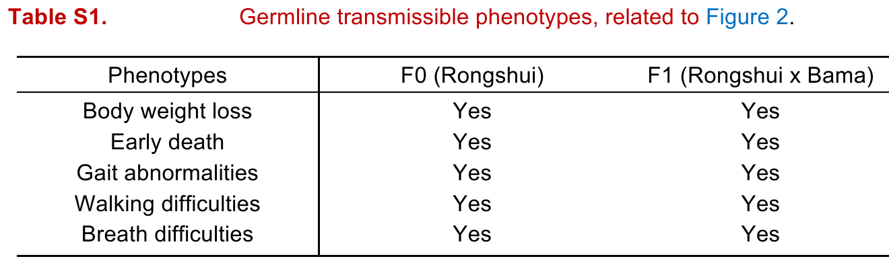
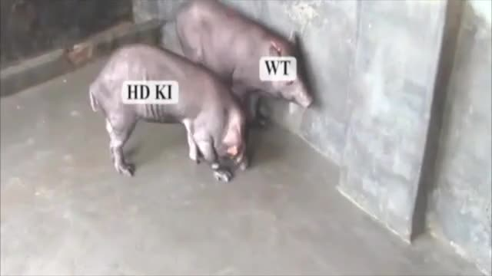
An edited donor separates gene and clone effects
A huntingtin knock-in pig study combined genome editing with SCNT. Knock-in means introducing a specified genetic alteration at a defined genomic location. The donor cells carried an altered huntingtin gene before nuclear transfer. The resulting founder pigs therefore had both a defined mutation and an SCNT production history. Those two properties describe different interventions.
Huntingtin is a protein whose mutant form causes Huntington’s disease in humans. The pig study examined a model carrying an expanded repeat associated with that disease. Investigators assessed molecular, tissue and behavioral outcomes. The resulting motor abnormalities were evaluated in relation to the engineered genotype. They were not presented as the ordinary behavior of all cloned pigs.
The experiment also produced later generations through breeding. These offspring inherited the altered gene through sexual reproduction. Their outcomes could be compared with the SCNT-derived founders. This separated transmission of the genetic alteration from repeating the cloning procedure. Genetic model, production method and generation must therefore remain identifiable in the behavioral comparison.
Yan et al. (2018), Table S1. Original comparison of clinical phenotypes in SCNT founder and bred offspring generations.
Yan (2018), Supplemental Video 1. SCNT founder behavior.
Yan et al. (2018)
29
Notes:
• A huntingtin knock-in pig study combined genome editing with SCNT. **Knock-in** means introducing a specified genetic alteration at a defined genomic location. The donor cells carried an altered huntingtin gene before nuclear transfer. The resulting founder pigs therefore had both a defined mutation and an SCNT production history. Those two properties describe different interventions.
• **Huntingtin** is a protein whose mutant form causes Huntington’s disease in humans. The pig study examined a model carrying an expanded repeat associated with that disease. Investigators assessed molecular, tissue and behavioral outcomes. The resulting motor abnormalities were evaluated in relation to the engineered genotype. They were not presented as the ordinary behavior of all cloned pigs.
• The experiment also produced later generations through breeding. These offspring inherited the altered gene through sexual reproduction. Their outcomes could be compared with the SCNT-derived founders. This separated transmission of the genetic alteration from repeating the cloning procedure. Genetic model, production method and generation must therefore remain identifiable in the behavioral comparison.
References:
Yan S, Tu Z, Liu Z, Fan N, Yang H, Yang S, Yang W, Zhao Y, Ouyang Z, Lai C, Yang H, Li L, Liu Q, Shi H, Xu G, Zhao H, Wei H, Pei Z, Li S, Lai L, Li XJ (2018). A Huntingtin Knockin Pig Model Recapitulates Features of Selective Neurodegeneration in Huntington's Disease. Cell 173(4):989-1002.e13. https://doi.org/10.1016/j.cell.2018.03.005
Figure: Yan et al. (2018), Table S1. Original comparison of clinical phenotypes in SCNT founder and bred offspring generations.
Figure source: https://doi.org/10.1016/j.cell.2018.03.005
Embedded video: Yan (2018), Supplemental Video 1. SCNT founder behavior.
Article: Yan S, Tu Z, Liu Z, Fan N, Yang H, Yang S, Yang W, Zhao Y, Ouyang Z, Lai C, Yang H, Li L, Liu Q, Shi H, Xu G, Zhao H, Wei H, Pei Z, Li S, Lai L, Li XJ. (2018). A Huntingtin Knockin Pig Model Recapitulates Features of Selective Neurodegeneration in Huntington's Disease. Cell 173:989-1002.e13. https://doi.org/10.1016/j.cell.2018.03.005
Exact source filename: PigHTT_mmc2.mp4
Original media/source page: https://ars.els-cdn.com/content/image/1-s2.0-S009286741830285X-mmc2.mp4
Original source hash: 27c28414f00c5de90a9fac9b5c1c129d7edfde0c04f98b4dd6224acdece25dce
Embedded clip hash: 3934b03f3ce2e5a3171c7f293fcb43005b1e0df1d02e1a60566621be840021a7
Source recording interval: 0.000–16.320 s. Original scientific frames, proportions, author-provided timing and available audio retained. Playback seconds are not necessarily biological elapsed time in source time-lapse/accelerated films.
License: Check the original article/media license before final delivery; no additional license inferred.
Native PPTX movie object with a separate static poster fallback. Desktop PowerPoint GUI playback and Google Slides import have not been tested. Google Slides may require inserting the supplied MP4 from Drive after import.

Slide 30
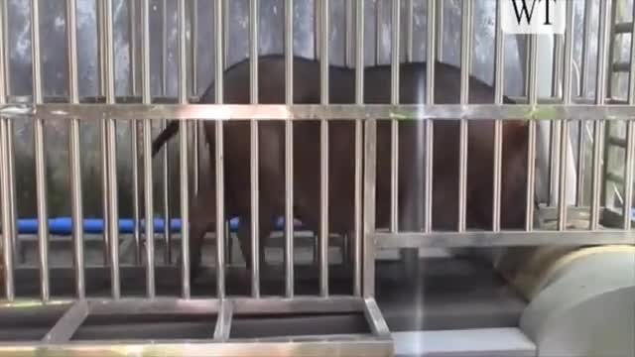
Huntingtin mutation changes a pig motor model
The huntingtin study recorded abnormal movement in affected pigs. The original recordings include walking and treadmill-related observations. A motor phenotype is a measurable characteristic of movement or its control. Comparing affected animals with controls connects that phenotype to the experimental preparation. The recordings preserve the animal’s actual behavior rather than a reconstructed animation.
The study also examined neuropathological changes associated with the engineered line. Neurodegeneration means progressive dysfunction and loss of neural tissue. The combination of tissue and behavioral assessment linked different levels of the disease model. Movement was one observable outcome of that model. Its interpretation depended on the defined huntingtin alteration.
An SCNT animal can carry a mutation introduced deliberately into its donor cells. Its resulting phenotype can therefore arise from that mutation. Comparing it with an unedited animal addresses a different question from comparing ordinary clones with naturally bred controls. The pig study maintained those distinctions through its genetic design. The behavioral outcome belonged to a specified engineered model.
Yan et al. (2018), Table S1. Original comparison of clinical phenotypes in SCNT founder and bred offspring generations.
Yan (2018), Supplemental Video 2. SCNT founder behavior.
Yan et al. (2018)
30
Notes:
• The huntingtin study recorded abnormal movement in affected pigs. The original recordings include walking and treadmill-related observations. A **motor phenotype** is a measurable characteristic of movement or its control. Comparing affected animals with controls connects that phenotype to the experimental preparation. The recordings preserve the animal’s actual behavior rather than a reconstructed animation.
• The study also examined neuropathological changes associated with the engineered line. **Neurodegeneration** means progressive dysfunction and loss of neural tissue. The combination of tissue and behavioral assessment linked different levels of the disease model. Movement was one observable outcome of that model. Its interpretation depended on the defined huntingtin alteration.
• An SCNT animal can carry a mutation introduced deliberately into its donor cells. Its resulting phenotype can therefore arise from that mutation. Comparing it with an unedited animal addresses a different question from comparing ordinary clones with naturally bred controls. The pig study maintained those distinctions through its genetic design. The behavioral outcome belonged to a specified engineered model.
References:
Yan S, Tu Z, Liu Z, Fan N, Yang H, Yang S, Yang W, Zhao Y, Ouyang Z, Lai C, Yang H, Li L, Liu Q, Shi H, Xu G, Zhao H, Wei H, Pei Z, Li S, Lai L, Li XJ (2018). A Huntingtin Knockin Pig Model Recapitulates Features of Selective Neurodegeneration in Huntington's Disease. Cell 173(4):989-1002.e13. https://doi.org/10.1016/j.cell.2018.03.005
Figure: Yan et al. (2018), Table S1. Original comparison of clinical phenotypes in SCNT founder and bred offspring generations.
Figure source: https://doi.org/10.1016/j.cell.2018.03.005
Embedded video: Yan (2018), Supplemental Video 2. SCNT founder behavior.
Article: Yan S, Tu Z, Liu Z, Fan N, Yang H, Yang S, Yang W, Zhao Y, Ouyang Z, Lai C, Yang H, Li L, Liu Q, Shi H, Xu G, Zhao H, Wei H, Pei Z, Li S, Lai L, Li XJ. (2018). A Huntingtin Knockin Pig Model Recapitulates Features of Selective Neurodegeneration in Huntington's Disease. Cell 173:989-1002.e13. https://doi.org/10.1016/j.cell.2018.03.005
Exact source filename: PigHTT_mmc3.mp4
Original media/source page: https://ars.els-cdn.com/content/image/1-s2.0-S009286741830285X-mmc3.mp4
Original source hash: 72bc53ee4560fd1d08dc887e6650bcb277e4f57756d56c6a919bd8584499621d
Embedded clip hash: 42b680727db6a9e6ca72fd803c6bcbe1e348f0e8f0e084210361a880c139e254
Source recording interval: 0.000–12.120 s. Original scientific frames, proportions, author-provided timing and available audio retained. Playback seconds are not necessarily biological elapsed time in source time-lapse/accelerated films.
License: Check the original article/media license before final delivery; no additional license inferred.
Native PPTX movie object with a separate static poster fallback. Desktop PowerPoint GUI playback and Google Slides import have not been tested. Google Slides may require inserting the supplied MP4 from Drive after import.

Slide 31
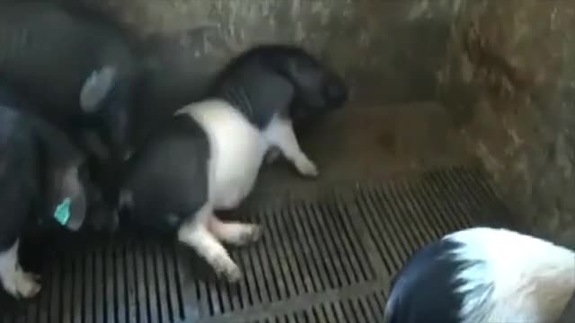
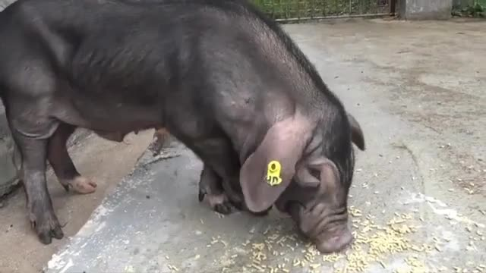
Bred descendants differ from SCNT founders
The huntingtin recordings also include sexually bred descendants of the engineered founders. These are not additional F0 SCNT clones. F0 denotes the founder generation, while F1 denotes its offspring. The distinction identifies how each animal was produced. It also identifies the route by which the altered gene reached that animal.
A behavioral phenotype that recurs in bred descendants can be examined independently of repeating SCNT. The study assessed inherited features of the huntingtin model across generations. Genetic measurements characterized the altered repeat. Behavioral and pathological observations characterized its consequences. The comparison therefore linked inheritance with phenotype through more than one production route.
Generation labels prevent superficially similar recordings from being conflated. A founder and a descendant may share a disease-associated alteration. Their embryonic origins nevertheless differ. The source videos retain those experimental identities. The comparison connects a defined genetic contribution with the behavior of animals that developed through different reproductive histories.
Yan et al. (2018), Table S1. Original comparison of clinical phenotypes in SCNT founder and bred offspring generations.
Yan (2018), Supplemental Video 3. Sexually bred F1 behavior, not an SCNT founder.
Yan (2018), Supplemental Video 4. Sexually bred F1 behavior, not an SCNT founder.
Yan et al. (2018)
31
Notes:
• The huntingtin recordings also include sexually bred descendants of the engineered founders. These are not additional F0 SCNT clones. **F0** denotes the founder generation, while F1 denotes its offspring. The distinction identifies how each animal was produced. It also identifies the route by which the altered gene reached that animal.
• A behavioral phenotype that recurs in bred descendants can be examined independently of repeating SCNT. The study assessed inherited features of the huntingtin model across generations. Genetic measurements characterized the altered repeat. Behavioral and pathological observations characterized its consequences. The comparison therefore linked inheritance with phenotype through more than one production route.
• Generation labels prevent superficially similar recordings from being conflated. A founder and a descendant may share a disease-associated alteration. Their embryonic origins nevertheless differ. The source videos retain those experimental identities. The comparison connects a defined genetic contribution with the behavior of animals that developed through different reproductive histories.
References:
Yan S, Tu Z, Liu Z, Fan N, Yang H, Yang S, Yang W, Zhao Y, Ouyang Z, Lai C, Yang H, Li L, Liu Q, Shi H, Xu G, Zhao H, Wei H, Pei Z, Li S, Lai L, Li XJ (2018). A Huntingtin Knockin Pig Model Recapitulates Features of Selective Neurodegeneration in Huntington's Disease. Cell 173(4):989-1002.e13. https://doi.org/10.1016/j.cell.2018.03.005
Figure: Yan et al. (2018), Table S1. Original comparison of clinical phenotypes in SCNT founder and bred offspring generations.
Figure source: https://doi.org/10.1016/j.cell.2018.03.005
Embedded video: Yan (2018), Supplemental Video 3. Sexually bred F1 behavior, not an SCNT founder.
Article: Yan S, Tu Z, Liu Z, Fan N, Yang H, Yang S, Yang W, Zhao Y, Ouyang Z, Lai C, Yang H, Li L, Liu Q, Shi H, Xu G, Zhao H, Wei H, Pei Z, Li S, Lai L, Li XJ. (2018). A Huntingtin Knockin Pig Model Recapitulates Features of Selective Neurodegeneration in Huntington's Disease. Cell 173:989-1002.e13. https://doi.org/10.1016/j.cell.2018.03.005
Exact source filename: PigHTT_mmc4.mp4
Original media/source page: https://ars.els-cdn.com/content/image/1-s2.0-S009286741830285X-mmc4.mp4
Original source hash: 6c4589cfc95338f17b5bccdd92e132eca8189056dace4625af0960d629897019
Embedded clip hash: b791b5f124cd8d86e6adf05ad17bb98ece8fec14da8cbea5bd2f6fa960e9d7a9
Source recording interval: 0.000–21.240 s. Original scientific frames, proportions, author-provided timing and available audio retained. Playback seconds are not necessarily biological elapsed time in source time-lapse/accelerated films.
License: Check the original article/media license before final delivery; no additional license inferred.
Native PPTX movie object with a separate static poster fallback. Desktop PowerPoint GUI playback and Google Slides import have not been tested. Google Slides may require inserting the supplied MP4 from Drive after import.
Embedded video: Yan (2018), Supplemental Video 4. Sexually bred F1 behavior, not an SCNT founder.
Article: Yan S, Tu Z, Liu Z, Fan N, Yang H, Yang S, Yang W, Zhao Y, Ouyang Z, Lai C, Yang H, Li L, Liu Q, Shi H, Xu G, Zhao H, Wei H, Pei Z, Li S, Lai L, Li XJ. (2018). A Huntingtin Knockin Pig Model Recapitulates Features of Selective Neurodegeneration in Huntington's Disease. Cell 173:989-1002.e13. https://doi.org/10.1016/j.cell.2018.03.005
Exact source filename: PigHTT_mmc5.mp4
Original media/source page: https://ars.els-cdn.com/content/image/1-s2.0-S009286741830285X-mmc5.mp4
Original source hash: 0c5cb9edcc9b96094f8562540162b757db9b8e56d0ee8416c2fc7b6efe0e88f7
Embedded clip hash: 2448f3888a52fe00b9b09132e49c2d92379f0e455fcab7d4262ec23ab5f56426
Source recording interval: 0.000–20.720 s. Original scientific frames, proportions, author-provided timing and available audio retained. Playback seconds are not necessarily biological elapsed time in source time-lapse/accelerated films.
License: Check the original article/media license before final delivery; no additional license inferred.
Native PPTX movie object with a separate static poster fallback. Desktop PowerPoint GUI playback and Google Slides import have not been tested. Google Slides may require inserting the supplied MP4 from Drive after import.

Slide 32
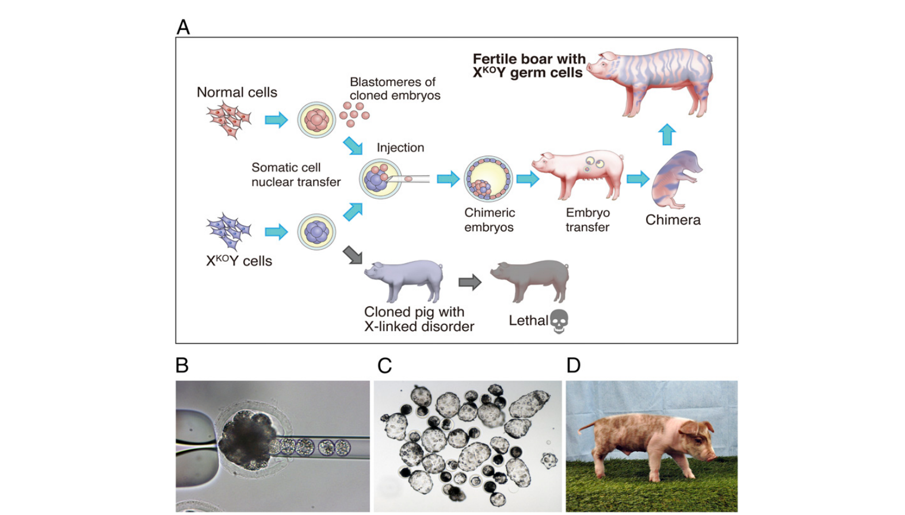
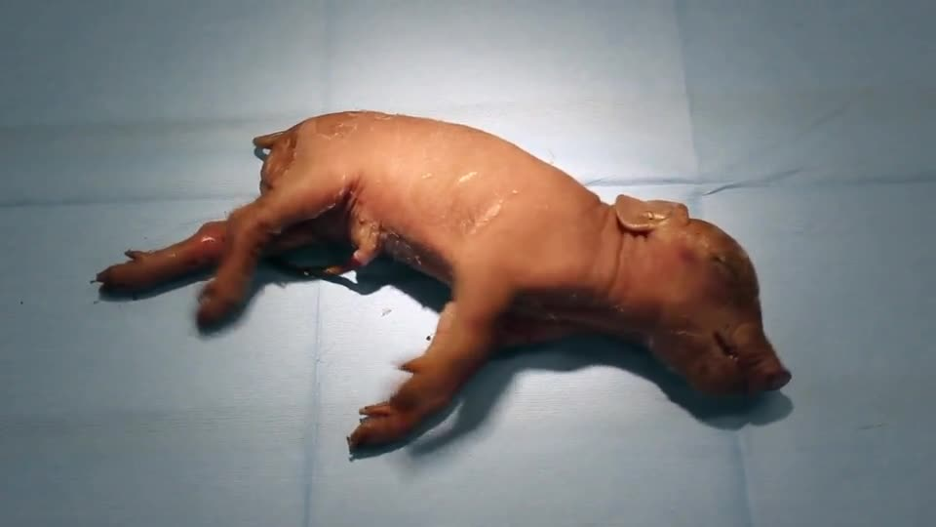
Metabolic mutations can alter behavior
The X-linked-disease study generated pigs with defined genetic defects. One model disrupted ornithine transcarbamylase, abbreviated OTC. This enzyme participates in the urea cycle. The urea cycle helps the body handle nitrogen produced during metabolism. Severe disruption can cause excessive ammonia accumulation and early neurological signs.
The study produced OTC-deficient founder animals through genome editing and somatic-cell cloning. It assessed clinical and metabolic features of the resulting model. Tremors and early illness occurred in the affected animals. The original supplementary recording documents the disease-associated behavior. Its interpretation depends on the enzyme defect and the animal’s identified generation.
X-linked genes are located on the X chromosome. Their inheritance affects how an engineered alteration appears in different offspring. The study followed both founder production and later breeding strategies. Genetic diagnosis and physiological measurements accompanied behavioral observation. A defined metabolic mutation therefore explains this model more specifically than the general label cloned pig.
Matsunari et al. (2018), Fig. 1. Chimeric-embryo strategy and the resulting genetically defined pig preparations.
Matsunari (2018), Movie S1. OTC-deficient genetic model.
Matsunari et al. (2018)
32
Notes:
• The X-linked-disease study generated pigs with defined genetic defects. One model disrupted **ornithine transcarbamylase**, abbreviated OTC. This enzyme participates in the urea cycle. The urea cycle helps the body handle nitrogen produced during metabolism. Severe disruption can cause excessive ammonia accumulation and early neurological signs.
• The study produced OTC-deficient founder animals through genome editing and somatic-cell cloning. It assessed clinical and metabolic features of the resulting model. Tremors and early illness occurred in the affected animals. The original supplementary recording documents the disease-associated behavior. Its interpretation depends on the enzyme defect and the animal’s identified generation.
• **X-linked** genes are located on the X chromosome. Their inheritance affects how an engineered alteration appears in different offspring. The study followed both founder production and later breeding strategies. Genetic diagnosis and physiological measurements accompanied behavioral observation. A defined metabolic mutation therefore explains this model more specifically than the general label cloned pig.
References:
Matsunari H, Watanabe M, Nakano K, Enosawa S, Umeyama K, Uchikura A, Yashima S, Fukuda T, Klymiuk N, Kurome M, Kessler B, Wuensch A, Zakhartchenko V, Wolf E, Hanazono Y, Nagaya M, Umezawa A, Nakauchi H, Nagashima H (2018). Modeling lethal X-linked genetic disorders in pigs with ensured fertility. Proceedings of the National Academy of Sciences of the United States of America 115(4):708-713. https://doi.org/10.1073/pnas.1715940115
Figure: Matsunari et al. (2018), Fig. 1. Chimeric-embryo strategy and the resulting genetically defined pig preparations.
Figure source: https://doi.org/10.1073/pnas.1715940115
Embedded video: Matsunari (2018), Movie S1. OTC-deficient genetic model.
Article: Matsunari H, Watanabe M, Nakano K, Enosawa S, Umeyama K, Uchikura A, Yashima S, Fukuda T, Klymiuk N, Kurome M, Kessler B, Wuensch A, Zakhartchenko V, Wolf E, Hanazono Y, Nagaya M, Umezawa A, Nakauchi H, Nagashima H. (2018). Modeling lethal X-linked genetic disorders in pigs with ensured fertility. Proceedings of the National Academy of Sciences of the United States of America 115:708-713. https://doi.org/10.1073/pnas.1715940115
Exact source filename: pnas.1715940115.sm01.mp4
Original media/source page: https://www.ebi.ac.uk/europepmc/webservices/rest/PMC5789933/supplementaryFiles
Original source hash: a9d538cb03db65c7d35f3e70b4078c5c068ebfc5d9b5a003d4fa493780e62b69
Embedded clip hash: 11031e04130f4bfee0c7151ec76252610167c50829f17c1f20df6a964781ec8f
Source recording interval: 0.000–10.978 s. Original scientific frames, proportions, author-provided timing and available audio retained. Playback seconds are not necessarily biological elapsed time in source time-lapse/accelerated films.
License: Original article-provided recording; consult the source article license.
Native PPTX movie object with a separate static poster fallback. Desktop PowerPoint GUI playback and Google Slides import have not been tested. Google Slides may require inserting the supplied MP4 from Drive after import.

Slide 33
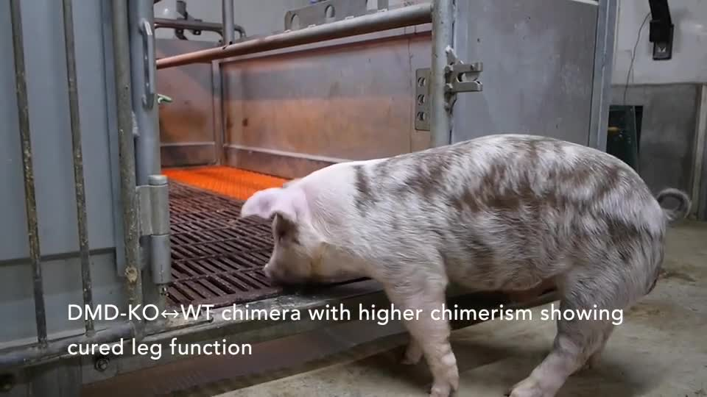
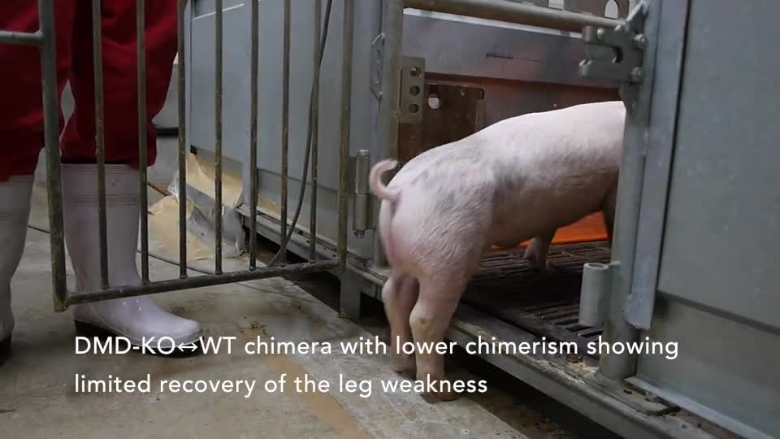
Chimeras contain different genetic contributions
A chimera contains cell populations with different genetic origins. The X-linked-disease study combined mutant and wild-type contributions in pig embryos. Wild type identifies the reference genotype without the engineered defect. The resulting animals differed from a uniform mutant clone. Their phenotype depended partly on the contributions present within their tissues.
The study included chimeras involving the dystrophin-deficient model. Dystrophin is a protein important for the stability of muscle fibers. Its deficiency can impair movement and breathing. The two recorded chimeras differed in clinical severity. Their cellular composition supplied a biologically relevant difference within the experimental design.
A shared disease-model label can therefore contain different tissue-level genetic mixtures. The researchers assessed those mixtures alongside phenotype. Movement and respiratory signs were interpreted within that context. The comparison connects cellular genetic contribution with organismal function. It separates chimerism from ordinary nuclear identity and from the presence of a mutation alone.
Matsunari et al. (2018), Fig. 1. Chimeric-embryo strategy and the resulting genetically defined pig preparations.
Matsunari (2018), Movie S2. DMD chimera 61.
Matsunari (2018), Movie S3. DMD chimera 62.
Matsunari et al. (2018)
33
Notes:
• A **chimera** contains cell populations with different genetic origins. The X-linked-disease study combined mutant and wild-type contributions in pig embryos. **Wild type** identifies the reference genotype without the engineered defect. The resulting animals differed from a uniform mutant clone. Their phenotype depended partly on the contributions present within their tissues.
• The study included chimeras involving the dystrophin-deficient model. **Dystrophin** is a protein important for the stability of muscle fibers. Its deficiency can impair movement and breathing. The two recorded chimeras differed in clinical severity. Their cellular composition supplied a biologically relevant difference within the experimental design.
• A shared disease-model label can therefore contain different tissue-level genetic mixtures. The researchers assessed those mixtures alongside phenotype. Movement and respiratory signs were interpreted within that context. The comparison connects cellular genetic contribution with organismal function. It separates chimerism from ordinary nuclear identity and from the presence of a mutation alone.
References:
Matsunari H, Watanabe M, Nakano K, Enosawa S, Umeyama K, Uchikura A, Yashima S, Fukuda T, Klymiuk N, Kurome M, Kessler B, Wuensch A, Zakhartchenko V, Wolf E, Hanazono Y, Nagaya M, Umezawa A, Nakauchi H, Nagashima H (2018). Modeling lethal X-linked genetic disorders in pigs with ensured fertility. Proceedings of the National Academy of Sciences of the United States of America 115(4):708-713. https://doi.org/10.1073/pnas.1715940115
Figure: Matsunari et al. (2018), Fig. 1. Chimeric-embryo strategy and the resulting genetically defined pig preparations.
Figure source: https://doi.org/10.1073/pnas.1715940115
Embedded video: Matsunari (2018), Movie S2. DMD chimera 61.
Article: Matsunari H, Watanabe M, Nakano K, Enosawa S, Umeyama K, Uchikura A, Yashima S, Fukuda T, Klymiuk N, Kurome M, Kessler B, Wuensch A, Zakhartchenko V, Wolf E, Hanazono Y, Nagaya M, Umezawa A, Nakauchi H, Nagashima H. (2018). Modeling lethal X-linked genetic disorders in pigs with ensured fertility. Proceedings of the National Academy of Sciences of the United States of America 115:708-713. https://doi.org/10.1073/pnas.1715940115
Exact source filename: pnas.1715940115.sm02.mp4
Original media/source page: https://www.ebi.ac.uk/europepmc/webservices/rest/PMC5789933/supplementaryFiles
Original source hash: a49ef2bf693a9cd2aae890bafc8faa8dadc728cc0afb28b972eaff312ff3cdd7
Embedded clip hash: 977d8289e75177c94b9d86459224422acee87b9993922e5ca388c6e88b5f9b95
Source recording interval: 0.000–12.379 s. Original scientific frames, proportions, author-provided timing and available audio retained. Playback seconds are not necessarily biological elapsed time in source time-lapse/accelerated films.
License: Original article-provided recording; consult the source article license.
Native PPTX movie object with a separate static poster fallback. Desktop PowerPoint GUI playback and Google Slides import have not been tested. Google Slides may require inserting the supplied MP4 from Drive after import.
Embedded video: Matsunari (2018), Movie S3. DMD chimera 62.
Article: Matsunari H, Watanabe M, Nakano K, Enosawa S, Umeyama K, Uchikura A, Yashima S, Fukuda T, Klymiuk N, Kurome M, Kessler B, Wuensch A, Zakhartchenko V, Wolf E, Hanazono Y, Nagaya M, Umezawa A, Nakauchi H, Nagashima H. (2018). Modeling lethal X-linked genetic disorders in pigs with ensured fertility. Proceedings of the National Academy of Sciences of the United States of America 115:708-713. https://doi.org/10.1073/pnas.1715940115
Exact source filename: pnas.1715940115.sm03.mp4
Original media/source page: https://www.ebi.ac.uk/europepmc/webservices/rest/PMC5789933/supplementaryFiles
Original source hash: 9d587a742375abc6262f273fe8b15141dd2f9fffa5a53c19f61a66fbaed9ce0a
Embedded clip hash: 9d53332b113e771e0644d1fa7c825ace8b6e4246c795c463f81484c53c21d5b8
Source recording interval: 0.000–14.982 s. Original scientific frames, proportions, author-provided timing and available audio retained. Playback seconds are not necessarily biological elapsed time in source time-lapse/accelerated films.
License: Original article-provided recording; consult the source article license.
Native PPTX movie object with a separate static poster fallback. Desktop PowerPoint GUI playback and Google Slides import have not been tested. Google Slides may require inserting the supplied MP4 from Drive after import.

Slide 34
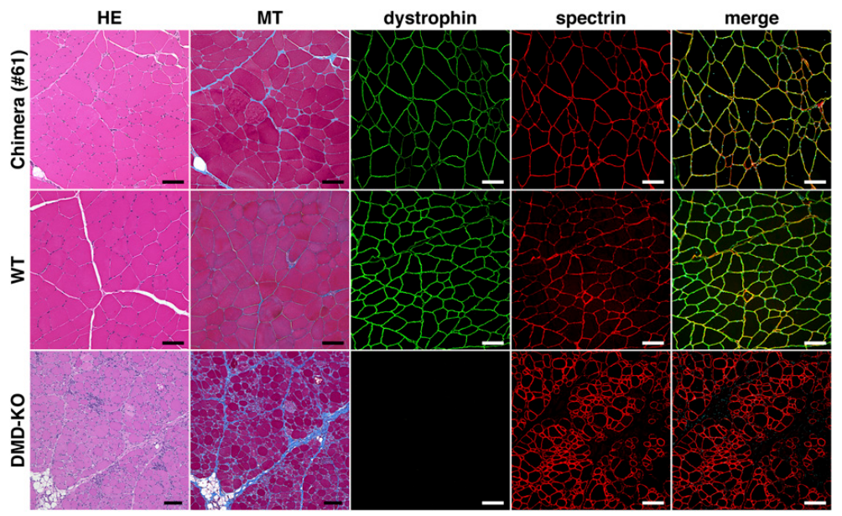
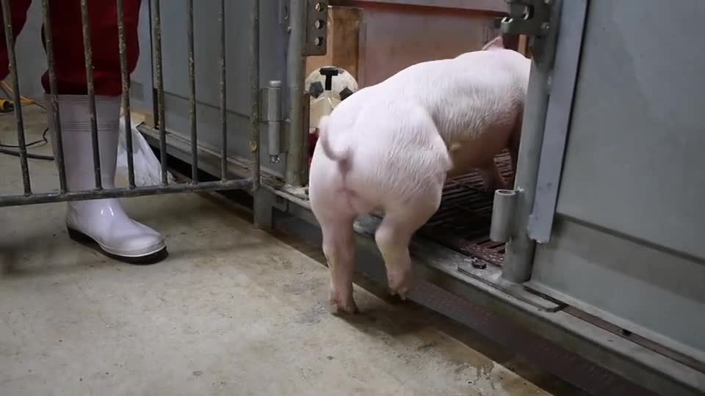
Dystrophin deficiency alters physical function
The dystrophin-deficient founder pigs were produced from genetically altered donor cells. Their SCNT origin and mutant genotype were separately defined. The study documented early disease and impaired physical function. The original recording preserves the affected animals’ movements. These are observations of a particular muscle-disease model rather than a general cloning outcome.
Dystrophin contributes to the structural integrity of muscle cells. Its disruption can weaken the tissues required for movement and breathing. Chimeric animals with a wild-type cellular contribution provided another comparison. Their outcomes differed with the composition of the tissues examined. The study therefore connected gene function, cellular contribution and whole-animal performance.
The same general production technology can create animals carrying very different genetic alterations. Their phenotypes must be interpreted through those alterations. An unedited clone, a uniform mutant clone and a chimera are distinct preparations. The pig experiments tested those distinctions directly. Behavioral similarity or difference consequently required the genetic and cellular identities of the animals to remain explicit.
Matsunari et al. (2018), Fig. 3. Muscle histology and immunofluorescence in the dystrophin-deficient chimera.
Matsunari (2018), Movie S4. DMD-knockout SCNT founder.
Matsunari et al. (2018)
34
Notes:
• The dystrophin-deficient founder pigs were produced from genetically altered donor cells. Their SCNT origin and mutant genotype were separately defined. The study documented early disease and impaired physical function. The original recording preserves the affected animals’ movements. These are observations of a particular muscle-disease model rather than a general cloning outcome.
• Dystrophin contributes to the structural integrity of muscle cells. Its disruption can weaken the tissues required for movement and breathing. Chimeric animals with a wild-type cellular contribution provided another comparison. Their outcomes differed with the composition of the tissues examined. The study therefore connected gene function, cellular contribution and whole-animal performance.
• The same general production technology can create animals carrying very different genetic alterations. Their phenotypes must be interpreted through those alterations. An unedited clone, a uniform mutant clone and a chimera are distinct preparations. The pig experiments tested those distinctions directly. Behavioral similarity or difference consequently required the genetic and cellular identities of the animals to remain explicit.
References:
Matsunari H, Watanabe M, Nakano K, Enosawa S, Umeyama K, Uchikura A, Yashima S, Fukuda T, Klymiuk N, Kurome M, Kessler B, Wuensch A, Zakhartchenko V, Wolf E, Hanazono Y, Nagaya M, Umezawa A, Nakauchi H, Nagashima H (2018). Modeling lethal X-linked genetic disorders in pigs with ensured fertility. Proceedings of the National Academy of Sciences of the United States of America 115(4):708-713. https://doi.org/10.1073/pnas.1715940115
Figure: Matsunari et al. (2018), Fig. 3. Muscle histology and immunofluorescence in the dystrophin-deficient chimera.
Figure source: https://doi.org/10.1073/pnas.1715940115
Embedded video: Matsunari (2018), Movie S4. DMD-knockout SCNT founder.
Article: Matsunari H, Watanabe M, Nakano K, Enosawa S, Umeyama K, Uchikura A, Yashima S, Fukuda T, Klymiuk N, Kurome M, Kessler B, Wuensch A, Zakhartchenko V, Wolf E, Hanazono Y, Nagaya M, Umezawa A, Nakauchi H, Nagashima H. (2018). Modeling lethal X-linked genetic disorders in pigs with ensured fertility. Proceedings of the National Academy of Sciences of the United States of America 115:708-713. https://doi.org/10.1073/pnas.1715940115
Exact source filename: pnas.1715940115.sm04.mp4
Original media/source page: https://www.ebi.ac.uk/europepmc/webservices/rest/PMC5789933/supplementaryFiles
Original source hash: 3e9e99a90d8105a21b9f4a5c4188ecb3fceb42da244b6b0b63598280ca170ded
Embedded clip hash: 257cb0d1cf2e3b703acf19f7de9e31b7481d3b4a91920a5f09232cf5755dbe87
Source recording interval: 0.000–26.493 s. Original scientific frames, proportions, author-provided timing and available audio retained. Playback seconds are not necessarily biological elapsed time in source time-lapse/accelerated films.
License: Original article-provided recording; consult the source article license.
Native PPTX movie object with a separate static poster fallback. Desktop PowerPoint GUI playback and Google Slides import have not been tested. Google Slides may require inserting the supplied MP4 from Drive after import.

Slide 35
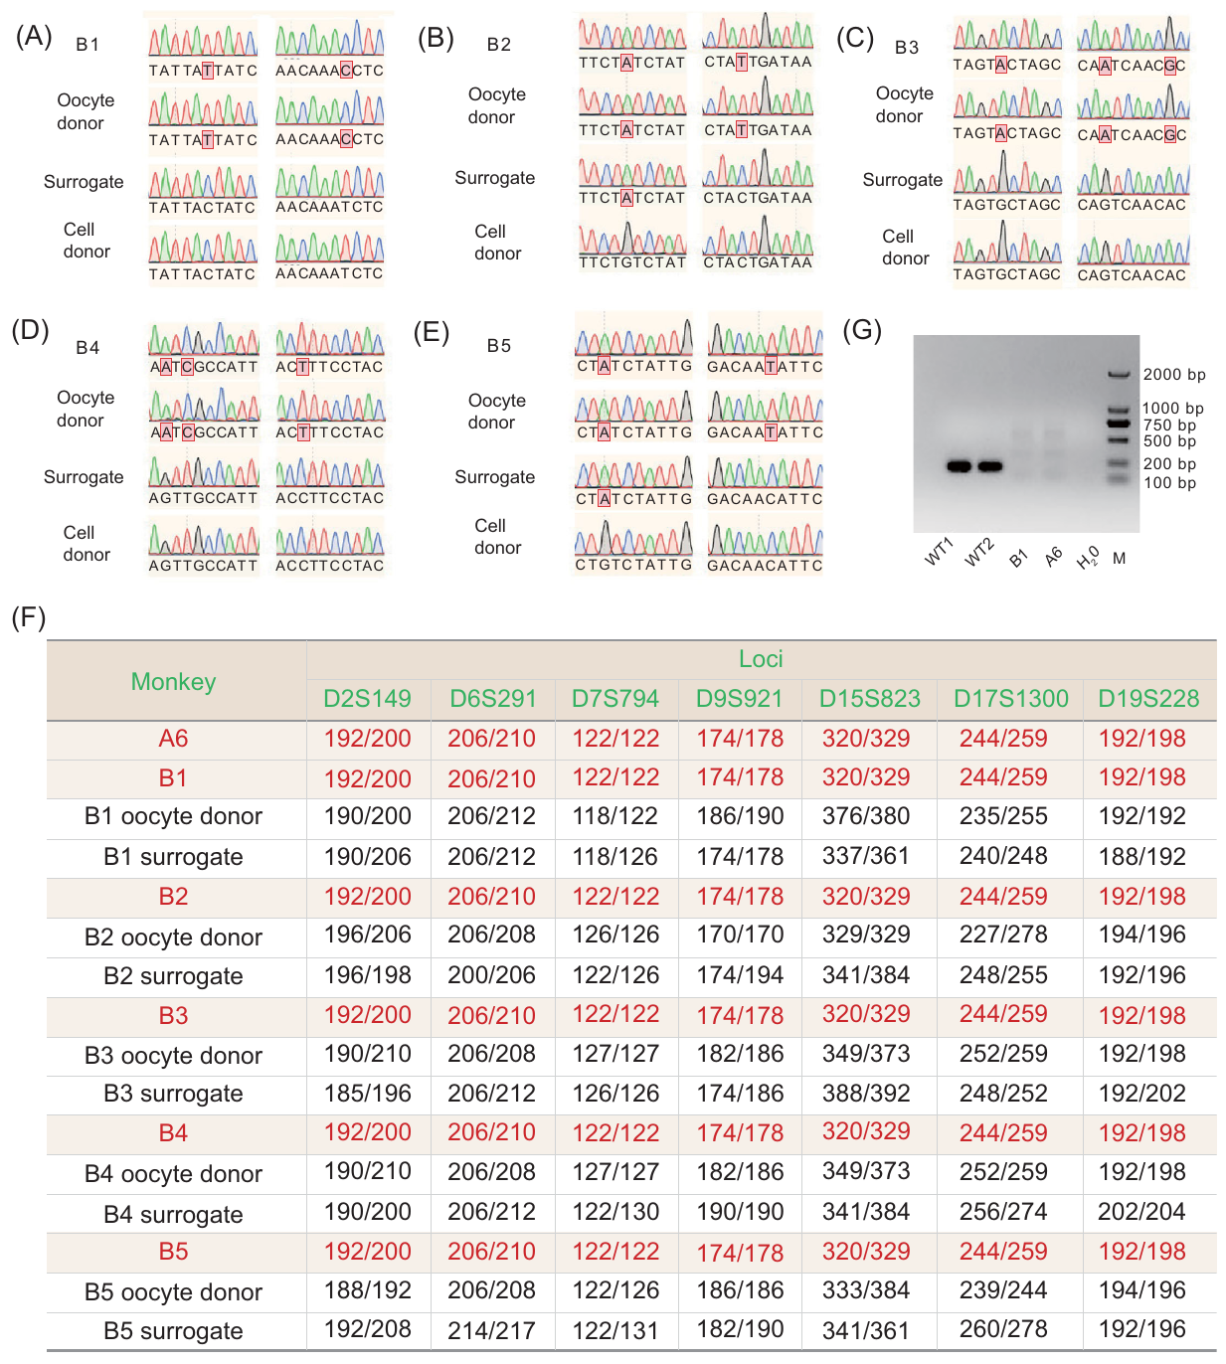
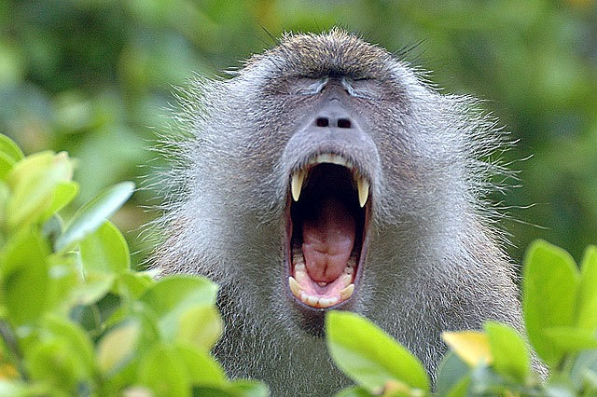
An edited macaque donor differs from its clone
The macaque study produced SCNT offspring using cells from a gene-edited donor. The edited gene was BMAL1, a regulator of the cellular circadian clock. Circadian processes vary over an approximately daily cycle. The donor’s genetic alteration was defined before the cloning procedure. The offspring’s production method was then established through SCNT and genetic testing.
The related behavioral study examined the gene-edited donor generation. Those observations were not measurements made in the cloned offspring. The distinction concerns which animals actually underwent the behavioral tests. A donor cell can transmit a defined nuclear genotype. It does not transfer a completed behavioral record to the resulting animal.
The cloning study assessed the identity and development of its offspring. The donor study assessed behavioral and physiological consequences of the edited gene. These measurements address related but different animals and questions. Their connection lies in the specified nuclear alteration. Comparing them requires the generation and preparation to remain explicit throughout the account.
Liu et al. (2019), Fig. 3. Nuclear and mitochondrial identity measurements in SCNT-derived macaques.
Photo: Macaca fascicularis. Roger Rittmaster. CC BY 4.0.
Liu et al. (2019)
35
Notes:
• The macaque study produced SCNT offspring using cells from a gene-edited donor. The edited gene was **BMAL1**, a regulator of the cellular circadian clock. **Circadian** processes vary over an approximately daily cycle. The donor’s genetic alteration was defined before the cloning procedure. The offspring’s production method was then established through SCNT and genetic testing.
• The related behavioral study examined the gene-edited donor generation. Those observations were not measurements made in the cloned offspring. The distinction concerns which animals actually underwent the behavioral tests. A donor cell can transmit a defined nuclear genotype. It does not transfer a completed behavioral record to the resulting animal.
• The cloning study assessed the identity and development of its offspring. The donor study assessed behavioral and physiological consequences of the edited gene. These measurements address related but different animals and questions. Their connection lies in the specified nuclear alteration. Comparing them requires the generation and preparation to remain explicit throughout the account.
References:
Liu Z, Cai Y, Liao Z, Xu Y, Wang Y, Wang Z, Jiang X, Li Y, Lu Y, Nie Y, Zhang X, Li C, Bian X, Poo MM, Chang HC, Sun Q (2019). Cloning of a gene-edited macaque monkey by somatic cell nuclear transfer. National science review 6(1):101-108. https://doi.org/10.1093/nsr/nwz003
Figure: Liu et al. (2019), Fig. 3. Nuclear and mitochondrial identity measurements in SCNT-derived macaques.
Figure source: https://doi.org/10.1093/nsr/nwz003
Image: Photo: Macaca fascicularis. Credit: (c) Roger Rittmaster, some rights reserved (CC BY). License: CC BY 4.0. Source: https://www.inaturalist.org/observations/36515966

Slide 36




Clock-gene changes affect daily and test activity
The BMAL1 behavioral study followed gene-edited macaques and controls. It recorded activity across light and dark periods. Locomotor activity describes bodily movement over time. The investigators compared its daily organization between genotypes. The experiment therefore measured when the animals were active as well as whether they moved.
BMAL1-deficient animals had disrupted circadian activity and hormonal patterns. The study also assessed sleep-related organization. A change in daily timing can alter the context in which behavior occurs. Activity measured at one time can consequently differ from the animal’s pattern across a complete day. Continuous recording preserved that temporal structure.
These animals were the edited donor generation associated with the cloning project. Their phenotype concerned the disrupted clock gene. The controls supplied a comparison without the same complete disruption. The study linked a specified genetic alteration with physiological and behavioral timing. It did not identify an ordinary behavioral property of all macaque clones. The investigators also tested behavior in a novel cage. Wild-type A5 and BMAL1-knockout A6 provided a directly recorded comparison.
Qiu et al. (2019), Fig. 2. Daily activity and hormonal patterns in edited-donor macaques and controls.
Photo: Macaca fascicularis. Donald Davesne. CC BY 4.0.
Qiu (2019), Movie S1. WT A5, novel cage; authors’ 16× display.
Qiu (2019), Movie S2. KO A6, novel cage; authors’ 16× display.
Qiu et al. (2019)
36
Notes:
• The BMAL1 behavioral study followed gene-edited macaques and controls. It recorded activity across light and dark periods. **Locomotor activity** describes bodily movement over time. The investigators compared its daily organization between genotypes. The experiment therefore measured when the animals were active as well as whether they moved.
• BMAL1-deficient animals had disrupted circadian activity and hormonal patterns. The study also assessed sleep-related organization. A change in daily timing can alter the context in which behavior occurs. Activity measured at one time can consequently differ from the animal’s pattern across a complete day. Continuous recording preserved that temporal structure.
• These animals were the edited donor generation associated with the cloning project. Their phenotype concerned the disrupted clock gene. The controls supplied a comparison without the same complete disruption. The study linked a specified genetic alteration with physiological and behavioral timing. It did not identify an ordinary behavioral property of all macaque clones. The investigators also tested behavior in a novel cage. Wild-type A5 and BMAL1-knockout A6 provided a directly recorded comparison.
References:
Qiu P, Jiang J, Liu Z, Cai Y, Huang T, Wang Y, Liu Q, Nie Y, Liu F, Cheng J, Li Q, Tang YC, Poo MM, Sun Q, Chang HC (2019). BMAL1 knockout macaque monkeys display reduced sleep and psychiatric disorders. National science review 6(1):87-100. https://doi.org/10.1093/nsr/nwz002
Figure: Qiu et al. (2019), Fig. 2. Daily activity and hormonal patterns in edited-donor macaques and controls.
Figure source: https://doi.org/10.1093/nsr/nwz002
Image: Photo: Macaca fascicularis. Credit: (c) Donald Davesne, some rights reserved (CC BY). License: CC BY 4.0. Source: https://www.inaturalist.org/observations/393601760
Embedded video: Qiu (2019), Movie S1. WT A5, novel cage; authors’ 16× display.
Article: Qiu P, Jiang J, Liu Z, Cai Y, Huang T, Wang Y, Liu Q, Nie Y, Liu F, Cheng J, Li Q, Tang YC, Poo MM, Sun Q, Chang HC. (2019). BMAL1 knockout macaque monkeys display reduced sleep and psychiatric disorders. National science review 6:87-100. https://doi.org/10.1093/nsr/nwz002
Exact source filename: Movie_S1.mp4
Original media/source page: https://www.ebi.ac.uk/europepmc/webservices/rest/PMC8291534/supplementaryFiles
Original source hash: 1dfd1293c838c39d7b7238ce8ced4403defab768f52f561d5410fdd6f8fe0d71
Embedded clip hash: 35401a3fd22422b30a8eab5e42eaeeb501c6f8199176efcd6139995914410a7e
Source recording interval: 0.000–78.971 s. Original scientific frames, proportions, author-provided timing and available audio retained. Playback seconds are not necessarily biological elapsed time in source time-lapse/accelerated films.
License: This is an Open Access article distributed under the terms of the Creative Commons Attribution License ( http://creativecommons.org/licenses/by/4.0/ ), which permits unrestricted reuse, distribution, and reproduction in any medium, provided the original work is properly cited.
Native PPTX movie object with a separate static poster fallback. Desktop PowerPoint GUI playback and Google Slides import have not been tested. Google Slides may require inserting the supplied MP4 from Drive after import.
Embedded video: Qiu (2019), Movie S2. KO A6, novel cage; authors’ 16× display.
Article: Qiu P, Jiang J, Liu Z, Cai Y, Huang T, Wang Y, Liu Q, Nie Y, Liu F, Cheng J, Li Q, Tang YC, Poo MM, Sun Q, Chang HC. (2019). BMAL1 knockout macaque monkeys display reduced sleep and psychiatric disorders. National science review 6:87-100. https://doi.org/10.1093/nsr/nwz002
Exact source filename: Movie_S2.mp4
Original media/source page: https://www.ebi.ac.uk/europepmc/webservices/rest/PMC8291534/supplementaryFiles
Original source hash: 52eeb184f4439a31a25eee49e2a8516bfbbcba01230a446fa2ad9975529f2d7a
Embedded clip hash: f2051e783f60410f73249c5a567c5c2abe5843df15b3484bf47db38a4bfff225
Source recording interval: 0.000–77.067 s. Original scientific frames, proportions, author-provided timing and available audio retained. Playback seconds are not necessarily biological elapsed time in source time-lapse/accelerated films.
License: This is an Open Access article distributed under the terms of the Creative Commons Attribution License ( http://creativecommons.org/licenses/by/4.0/ ), which permits unrestricted reuse, distribution, and reproduction in any medium, provided the original work is properly cited.
Native PPTX movie object with a separate static poster fallback. Desktop PowerPoint GUI playback and Google Slides import have not been tested. Google Slides may require inserting the supplied MP4 from Drive after import.

Slide 37




Novel settings reveal conditional responses
The macaque study recorded behavior after placement in a new cage. This changed the animals’ immediate environment. Control animals explored the setting more actively. BMAL1-deficient animals spent more time stationary and used the space differently. The preparation connected a defined genotype with responses to an environmental change.
The researchers measured movement, spatial distribution and time off the ground. These observations describe different features of the response. Reduced movement and avoidance of a particular area are not identical measures. The recordings preserve those distinctions within the test setting. The comparison therefore produced a behavioral profile rather than a single label of abnormality.
The study also assessed hormonal changes associated with the disrupted clock. Cortisol is a hormone involved in physiological responses to challenge. Its regulation differed in the edited animals. Behavioral observations and hormonal measurements therefore described related aspects of the experimental phenotype. The animals’ genetic alteration and the test context both remained identifiable.
Qiu et al. (2019), Fig. 4(A–C). Novel-cage behavior and spatial activity in edited-donor macaques.
Photo: Macaca fascicularis. no rights reserved. CC0 1.0.
Qiu (2019), Movie S3. WT A7, novel cage; authors’ 16× display.
Qiu (2019), Movie S4. KO A3, novel cage; authors’ 16× display.
Qiu et al. (2019)
37
Notes:
• The macaque study recorded behavior after placement in a new cage. This changed the animals’ immediate environment. Control animals explored the setting more actively. BMAL1-deficient animals spent more time stationary and used the space differently. The preparation connected a defined genotype with responses to an environmental change.
• The researchers measured movement, spatial distribution and time off the ground. These observations describe different features of the response. Reduced movement and avoidance of a particular area are not identical measures. The recordings preserve those distinctions within the test setting. The comparison therefore produced a behavioral profile rather than a single label of abnormality.
• The study also assessed hormonal changes associated with the disrupted clock. Cortisol is a hormone involved in physiological responses to challenge. Its regulation differed in the edited animals. Behavioral observations and hormonal measurements therefore described related aspects of the experimental phenotype. The animals’ genetic alteration and the test context both remained identifiable.
References:
Qiu P, Jiang J, Liu Z, Cai Y, Huang T, Wang Y, Liu Q, Nie Y, Liu F, Cheng J, Li Q, Tang YC, Poo MM, Sun Q, Chang HC (2019). BMAL1 knockout macaque monkeys display reduced sleep and psychiatric disorders. National science review 6(1):87-100. https://doi.org/10.1093/nsr/nwz002
Figure: Qiu et al. (2019), Fig. 4(A–C). Novel-cage behavior and spatial activity in edited-donor macaques.
Figure source: https://doi.org/10.1093/nsr/nwz002
Image: Photo: Macaca fascicularis. Credit: no rights reserved. License: CC0 1.0. Source: https://www.inaturalist.org/observations/405140408
Embedded video: Qiu (2019), Movie S3. WT A7, novel cage; authors’ 16× display.
Article: Qiu P, Jiang J, Liu Z, Cai Y, Huang T, Wang Y, Liu Q, Nie Y, Liu F, Cheng J, Li Q, Tang YC, Poo MM, Sun Q, Chang HC. (2019). BMAL1 knockout macaque monkeys display reduced sleep and psychiatric disorders. National science review 6:87-100. https://doi.org/10.1093/nsr/nwz002
Exact source filename: Movie_S3.mp4
Original media/source page: https://www.ebi.ac.uk/europepmc/webservices/rest/PMC8291534/supplementaryFiles
Original source hash: 84eb721dbf4330dc04ec7f95f2417249f656fc21ad3558d7b518ee6948587e7d
Embedded clip hash: fc99a005e541ba0fee763296cad092aa72fc7106577051473db98af4d794ce42
Source recording interval: 0.000–77.067 s. Original scientific frames, proportions, author-provided timing and available audio retained. Playback seconds are not necessarily biological elapsed time in source time-lapse/accelerated films.
License: This is an Open Access article distributed under the terms of the Creative Commons Attribution License ( http://creativecommons.org/licenses/by/4.0/ ), which permits unrestricted reuse, distribution, and reproduction in any medium, provided the original work is properly cited.
Native PPTX movie object with a separate static poster fallback. Desktop PowerPoint GUI playback and Google Slides import have not been tested. Google Slides may require inserting the supplied MP4 from Drive after import.
Embedded video: Qiu (2019), Movie S4. KO A3, novel cage; authors’ 16× display.
Article: Qiu P, Jiang J, Liu Z, Cai Y, Huang T, Wang Y, Liu Q, Nie Y, Liu F, Cheng J, Li Q, Tang YC, Poo MM, Sun Q, Chang HC. (2019). BMAL1 knockout macaque monkeys display reduced sleep and psychiatric disorders. National science review 6:87-100. https://doi.org/10.1093/nsr/nwz002
Exact source filename: Movie_S4.mp4
Original media/source page: https://www.ebi.ac.uk/europepmc/webservices/rest/PMC8291534/supplementaryFiles
Original source hash: 7b58b7db9223c011192744ba6c0a587c3b3cd235e8504d137dbdc32dbfd79c4d
Embedded clip hash: 66a2c98df2286ea187b6a20c3a78553fac360c84e69f0e7557a0852d44c7133d
Source recording interval: 0.000–76.974 s. Original scientific frames, proportions, author-provided timing and available audio retained. Playback seconds are not necessarily biological elapsed time in source time-lapse/accelerated films.
License: This is an Open Access article distributed under the terms of the Creative Commons Attribution License ( http://creativecommons.org/licenses/by/4.0/ ), which permits unrestricted reuse, distribution, and reproduction in any medium, provided the original work is properly cited.
Native PPTX movie object with a separate static poster fallback. Desktop PowerPoint GUI playback and Google Slides import have not been tested. Google Slides may require inserting the supplied MP4 from Drive after import.

Slide 38


Human approach changes an immediate response
One BMAL1-deficient macaque displayed pronounced avoidance of care personnel. The source recordings include withdrawal and a head-covering posture. These observations occurred in a particular social situation. The same behavior was not continuously present when the animal was undisturbed. Its expression therefore depended on the immediate context as well as the animal’s genotype.
The investigators compared behavior in several recorded situations. A novel cage and a person’s approach supply different stimuli. Their consequences can be described through movement and posture. The recordings retain the original circumstances of those responses. This makes the environmental trigger part of the experimental account rather than an unspecified background condition.
A behavioral phenotype can be conditional without being unmeasurable. The relevant condition must be identified and reproduced during assessment. The macaque observations connected a defined genetic preparation with responses to particular situations. They concerned edited donor animals rather than the cloned offspring. Genotype, generation and immediate environment therefore describe separate parts of the result.
Qiu et al. (2019), Fig. 4(A–C). Novel-cage behavior and spatial activity in edited-donor macaques.
Qiu (2019), Movie S5. WT A5, care-personnel approach.
Qiu (2019), Movie S6. KO A6, care-personnel approach.
Qiu et al. (2019)
38
Notes:
• One BMAL1-deficient macaque displayed pronounced avoidance of care personnel. The source recordings include withdrawal and a head-covering posture. These observations occurred in a particular social situation. The same behavior was not continuously present when the animal was undisturbed. Its expression therefore depended on the immediate context as well as the animal’s genotype.
• The investigators compared behavior in several recorded situations. A novel cage and a person’s approach supply different stimuli. Their consequences can be described through movement and posture. The recordings retain the original circumstances of those responses. This makes the environmental trigger part of the experimental account rather than an unspecified background condition.
• A behavioral phenotype can be conditional without being unmeasurable. The relevant condition must be identified and reproduced during assessment. The macaque observations connected a defined genetic preparation with responses to particular situations. They concerned edited donor animals rather than the cloned offspring. Genotype, generation and immediate environment therefore describe separate parts of the result.
References:
Qiu P, Jiang J, Liu Z, Cai Y, Huang T, Wang Y, Liu Q, Nie Y, Liu F, Cheng J, Li Q, Tang YC, Poo MM, Sun Q, Chang HC (2019). BMAL1 knockout macaque monkeys display reduced sleep and psychiatric disorders. National science review 6(1):87-100. https://doi.org/10.1093/nsr/nwz002
Figure: Qiu et al. (2019), Fig. 4(A–C). Novel-cage behavior and spatial activity in edited-donor macaques.
Figure source: https://doi.org/10.1093/nsr/nwz002
Embedded video: Qiu (2019), Movie S5. WT A5, care-personnel approach.
Article: Qiu P, Jiang J, Liu Z, Cai Y, Huang T, Wang Y, Liu Q, Nie Y, Liu F, Cheng J, Li Q, Tang YC, Poo MM, Sun Q, Chang HC. (2019). BMAL1 knockout macaque monkeys display reduced sleep and psychiatric disorders. National science review 6:87-100. https://doi.org/10.1093/nsr/nwz002
Exact source filename: Movie_S5.mp4
Original media/source page: https://www.ebi.ac.uk/europepmc/webservices/rest/PMC8291534/supplementaryFiles
Original source hash: 180be80e38371c8d8b9000f71ddbefa99d6b83545199595868145e76b0632d7a
Embedded clip hash: bd4027bf7d2263d1c718c6aa4a467ff96ab479d86da24c5c1bae24ab4f240547
Source recording interval: 0.000–15.000 s. Original scientific frames, proportions, author-provided timing and available audio retained. Playback seconds are not necessarily biological elapsed time in source time-lapse/accelerated films.
License: This is an Open Access article distributed under the terms of the Creative Commons Attribution License ( http://creativecommons.org/licenses/by/4.0/ ), which permits unrestricted reuse, distribution, and reproduction in any medium, provided the original work is properly cited.
Native PPTX movie object with a separate static poster fallback. Desktop PowerPoint GUI playback and Google Slides import have not been tested. Google Slides may require inserting the supplied MP4 from Drive after import.
Embedded video: Qiu (2019), Movie S6. KO A6, care-personnel approach.
Article: Qiu P, Jiang J, Liu Z, Cai Y, Huang T, Wang Y, Liu Q, Nie Y, Liu F, Cheng J, Li Q, Tang YC, Poo MM, Sun Q, Chang HC. (2019). BMAL1 knockout macaque monkeys display reduced sleep and psychiatric disorders. National science review 6:87-100. https://doi.org/10.1093/nsr/nwz002
Exact source filename: Movie_S6.mp4
Original media/source page: https://www.ebi.ac.uk/europepmc/webservices/rest/PMC8291534/supplementaryFiles
Original source hash: 1d0c16c564fb7f5305b4a841571629a8e5b4f3bb2cbefce21f4e5960a2c1c0af
Embedded clip hash: 10cb6b37fb8d0857bd2e114659464bf7b0a0d54dead448933b278c4e70894d25
Source recording interval: 0.000–15.000 s. Original scientific frames, proportions, author-provided timing and available audio retained. Playback seconds are not necessarily biological elapsed time in source time-lapse/accelerated films.
License: This is an Open Access article distributed under the terms of the Creative Commons Attribution License ( http://creativecommons.org/licenses/by/4.0/ ), which permits unrestricted reuse, distribution, and reproduction in any medium, provided the original work is properly cited.
Native PPTX movie object with a separate static poster fallback. Desktop PowerPoint GUI playback and Google Slides import have not been tested. Google Slides may require inserting the supplied MP4 from Drive after import.

Slide 39


Clonal fish develop individual tendencies
Amazon mollies provide a naturally clonal comparison for studying individuality. Their reproductive biology differs from somatic cell nuclear transfer. The fish study used genetically matched animals reared under closely controlled conditions. It then repeatedly measured behavior in an open-field setting. The preparation examined individuality without creating an SCNT embryo.
The investigators compared fish separated at different early developmental times. Some animals experienced near-identical individual rearing from birth. The fish nevertheless developed measurable behavioral differences. Repeated observations distinguished persistent individual tendencies from a single unusual trial. Genetic matching and controlled rearing did not eliminate individuality within this preparation.
Repeatability describes the persistence of an individual’s relative behavior across observations. It is different from behaving identically on every occasion. The fish could vary from trial to trial while retaining individual patterns. The study measured those patterns directly. Natural cloning therefore supplied a comparative system for examining behavioral differences within a closely matched genetic background.
Bierbach et al. (2017), Fig. 2. Repeated open-field behavior of naturally clonal Amazon mollies.
Photo: Poecilia formosa. Jackie T. CC BY 4.0.
Bierbach et al. (2017)
39
Notes:
• Amazon mollies provide a naturally clonal comparison for studying individuality. Their reproductive biology differs from somatic cell nuclear transfer. The fish study used genetically matched animals reared under closely controlled conditions. It then repeatedly measured behavior in an open-field setting. The preparation examined individuality without creating an SCNT embryo.
• The investigators compared fish separated at different early developmental times. Some animals experienced near-identical individual rearing from birth. The fish nevertheless developed measurable behavioral differences. Repeated observations distinguished persistent individual tendencies from a single unusual trial. Genetic matching and controlled rearing did not eliminate individuality within this preparation.
• **Repeatability** describes the persistence of an individual’s relative behavior across observations. It is different from behaving identically on every occasion. The fish could vary from trial to trial while retaining individual patterns. The study measured those patterns directly. Natural cloning therefore supplied a comparative system for examining behavioral differences within a closely matched genetic background.
References:
Bierbach D, Laskowski KL, Wolf M (2017). Behavioural individuality in clonal fish arises despite near-identical rearing conditions. Nature communications 8:15361. https://doi.org/10.1038/ncomms15361
Figure: Bierbach et al. (2017), Fig. 2. Repeated open-field behavior of naturally clonal Amazon mollies.
Figure source: https://doi.org/10.1038/ncomms15361
Image: Photo: Poecilia formosa. Credit: (c) Jackie T, some rights reserved (CC BY). License: CC BY 4.0. Source: https://www.inaturalist.org/observations/323112681

Slide 40


Individuality follows developmental trajectories
A later clonal-fish study followed the emergence of individual behavior through development. A behavioral trajectory is the pattern of change across successive observations. Measuring a trajectory differs from assigning an animal a single lifelong score. The researchers examined how individual differences appeared and changed. Developmental time became part of the description of individuality.
The fish shared a clonal genetic background. Their behavior was nevertheless measured repeatedly rather than inferred from that shared origin. Some observations described changes within an individual. Others described differences between individuals. Keeping these levels separate connected development with the persistence and change of behavioral tendencies.
An individual phenotype is therefore a history as well as a measurement. Early behavior need not predict every later action in the same way. Repeated assessment identifies when a tendency becomes distinguishable. It also reveals whether that tendency changes. The clonal-fish work makes the development of individuality a directly observed biological process.
Laskowski et al. (2022), Fig. 3. Developmental trajectories of individual swimming behavior in clonal fish.
Photo: Poecilia formosa. Fishes of Texas team. CC BY-SA 4.0.
Laskowski et al. (2022)
40
Notes:
• A later clonal-fish study followed the emergence of individual behavior through development. A **behavioral trajectory** is the pattern of change across successive observations. Measuring a trajectory differs from assigning an animal a single lifelong score. The researchers examined how individual differences appeared and changed. Developmental time became part of the description of individuality.
• The fish shared a clonal genetic background. Their behavior was nevertheless measured repeatedly rather than inferred from that shared origin. Some observations described changes within an individual. Others described differences between individuals. Keeping these levels separate connected development with the persistence and change of behavioral tendencies.
• An individual phenotype is therefore a history as well as a measurement. Early behavior need not predict every later action in the same way. Repeated assessment identifies when a tendency becomes distinguishable. It also reveals whether that tendency changes. The clonal-fish work makes the development of individuality a directly observed biological process.
References:
Laskowski KL, Bierbach D, Jolles JW, Doran C, Wolf M (2022). The emergence and development of behavioral individuality in clonal fish. Nature communications 13(1):6419. https://doi.org/10.1038/s41467-022-34113-y
Figure: Laskowski et al. (2022), Fig. 3. Developmental trajectories of individual swimming behavior in clonal fish.
Figure source: https://doi.org/10.1038/s41467-022-34113-y
Image: Photo: Poecilia formosa. Credit: (c) Fishes of Texas team, some rights reserved (CC BY-SA). License: CC BY-SA 4.0. Source: https://www.inaturalist.org/observations/18942667

Slide 41


Early behavior connects with later life history
The life-history study followed behavior and later outcomes in clonal fish. Life history includes growth, reproduction and survival-related characteristics across an animal’s life. The researchers related early behavioral measurements to later individual outcomes. Their design extended observation beyond an immediate testing session. A behavioral tendency could consequently be examined within a longer developmental history.
The animals shared a closely matched genetic background. Later traits still had to be measured separately in each individual. The study examined relationships among behavior, growth and reproductive outcomes. Such relationships connect different levels of phenotype. They do not require those traits to be fixed in identical ways across every animal.
A cloned genetic source constrains one contribution to development. It does not replace the animal’s subsequent trajectory. Repeated behavioral and life-history measurements preserve that trajectory. The fish comparison therefore complements the mammalian SCNT studies. It links genetic matching with the emergence of persistent, measurable individual outcomes.
Scherer et al. (2023), Fig. 1. Individual reproductive and growth-related outcomes in clonal fish.
Photo: Poecilia formosa. Fishes of Texas team. CC BY-SA 4.0.
Scherer et al. (2023)
41
Notes:
• The life-history study followed behavior and later outcomes in clonal fish. **Life history** includes growth, reproduction and survival-related characteristics across an animal’s life. The researchers related early behavioral measurements to later individual outcomes. Their design extended observation beyond an immediate testing session. A behavioral tendency could consequently be examined within a longer developmental history.
• The animals shared a closely matched genetic background. Later traits still had to be measured separately in each individual. The study examined relationships among behavior, growth and reproductive outcomes. Such relationships connect different levels of phenotype. They do not require those traits to be fixed in identical ways across every animal.
• A cloned genetic source constrains one contribution to development. It does not replace the animal’s subsequent trajectory. Repeated behavioral and life-history measurements preserve that trajectory. The fish comparison therefore complements the mammalian SCNT studies. It links genetic matching with the emergence of persistent, measurable individual outcomes.
References:
Scherer U, Ehlman SM, Bierbach D, Krause J, Wolf M (2023). Reproductive individuality of clonal fish raised in near-identical environments and its link to early-life behavioral individuality. Nature communications 14(1):7652. https://doi.org/10.1038/s41467-023-43069-6
Figure: Scherer et al. (2023), Fig. 1. Individual reproductive and growth-related outcomes in clonal fish.
Figure source: https://doi.org/10.1038/s41467-023-43069-6
Image: Photo: Poecilia formosa. Credit: (c) Fishes of Texas team, some rights reserved (CC BY-SA). License: CC BY-SA 4.0. Source: https://www.inaturalist.org/observations/18945989

Slide 42



Receptor disruption changes ant brain anatomy
The clonal raider ant reproduces through natural clonal reproduction. It is not an SCNT animal. Trible and colleagues disrupted orco, a gene required for the function of many insect odorant receptors. These receptors contribute to detection of chemical cues. The experiment connected a specified genetic alteration with sensory and neural development.
The antennal lobe is a brain region receiving olfactory input. Its glomeruli are organized processing compartments within that region. Orco-disrupted ants had a substantially reduced complement of glomeruli. The original three-dimensional reconstructions record this anatomical difference. The mutation therefore affected brain organization as well as sensory behavior.
A naturally clonal background supplies a controlled setting for manipulating a particular gene. The edited animals and reference animals can still differ because of that manipulation. The anatomical comparison identifies one resulting phenotype. It connects receptor function with the development of neural processing structures. Genetic matching and experimental gene alteration must consequently remain separate descriptions of the preparation.
Trible et al. (2017), Table S1. Original published odorant-receptor and antennal-lobe glomerulus counts across insects.
Photo: Ooceraea biroi. Marco Chan. CC BY 4.0.
Trible (2017), Movie S1, ant segment. Wild-type and orco-mutant ant brain reconstructions.
Trible et al. (2017)
42
Notes:
• The clonal raider ant reproduces through natural clonal reproduction. It is not an SCNT animal. Trible and colleagues disrupted **orco**, a gene required for the function of many insect odorant receptors. These receptors contribute to detection of chemical cues. The experiment connected a specified genetic alteration with sensory and neural development.
• The **antennal lobe** is a brain region receiving olfactory input. Its **glomeruli** are organized processing compartments within that region. Orco-disrupted ants had a substantially reduced complement of glomeruli. The original three-dimensional reconstructions record this anatomical difference. The mutation therefore affected brain organization as well as sensory behavior.
• A naturally clonal background supplies a controlled setting for manipulating a particular gene. The edited animals and reference animals can still differ because of that manipulation. The anatomical comparison identifies one resulting phenotype. It connects receptor function with the development of neural processing structures. Genetic matching and experimental gene alteration must consequently remain separate descriptions of the preparation.
References:
Trible W, Olivos-Cisneros L, McKenzie SK, Saragosti J, Chang NC, Matthews BJ, Oxley PR, Kronauer DJC (2017). orco Mutagenesis Causes Loss of Antennal Lobe Glomeruli and Impaired Social Behavior in Ants. Cell 170(4):727-735.e10. https://doi.org/10.1016/j.cell.2017.07.001
Figure: Trible et al. (2017), Table S1. Original published odorant-receptor and antennal-lobe glomerulus counts across insects.
Figure source: https://doi.org/10.1016/j.cell.2017.07.001
Image: Photo: Ooceraea biroi. Credit: (c) Marco Chan, some rights reserved (CC BY). License: CC BY 4.0. Source: https://www.inaturalist.org/observations/250512444
Embedded video: Trible (2017), Movie S1, ant segment. Wild-type and orco-mutant ant brain reconstructions.
Article: Trible W, Olivos-Cisneros L, McKenzie SK, Saragosti J, Chang NC, Matthews BJ, Oxley PR, Kronauer DJC. (2017). orco Mutagenesis Causes Loss of Antennal Lobe Glomeruli and Impaired Social Behavior in Ants. Cell 170:727-735.e10. https://doi.org/10.1016/j.cell.2017.07.001
Exact source filename: Orco2017_mmc3.mp4
Original media/source page: https://ars.els-cdn.com/content/image/1-s2.0-S0092867417307729-mmc3.mp4
Original source hash: 02f29409a6d5bcab4a8e905fdcd6c5d889ac9cd19dcc292f956ce005e0e78da5
Embedded clip hash: 6d82601dbfb6545a7e26d8eb24ce8398b025fa3469abfdaea155a0ed2f316c64
Source recording interval: 0.000–27.210 s. Original scientific frames, proportions, author-provided timing and available audio retained. Playback seconds are not necessarily biological elapsed time in source time-lapse/accelerated films.
License: Check the original article/media license before final delivery; no additional license inferred.
Native PPTX movie object with a separate static poster fallback. Desktop PowerPoint GUI playback and Google Slides import have not been tested. Google Slides may require inserting the supplied MP4 from Drive after import.

Slide 43



Chemical avoidance depends on sensory function
The orco study examined behavioral responses to chemical markings. Wild-type and genetically altered ants were compared in the same type of assay. The source recording distinguishes odor-bearing lines from printed visual lines. This arrangement separates chemical information from a superficially similar visible boundary. The comparison addresses which sensory information guides avoidance. Clonal raider ants are blind, so the printed grid does not imply that they use vision to solve this assay.
Avoidance is movement that reduces approach to or contact with a stimulus. Its expression depends on the animal’s ability to detect relevant cues. Orco disruption altered the ants’ responses in the assay. The result connects a defined receptor-related mutation with a measurable action. It extends the anatomical comparison into the animal’s behavior.
The authors supplied recordings for the experimental conditions. Their original labels identify the animals and stimulus arrangement. The videos retain those labels and the authors’ recorded timing. Different genotypes can therefore be compared within the actual preparation. The study links a genetic intervention with both sensory organization and behavior.
Trible et al. (2017), Table S1. Original published odorant-receptor and antennal-lobe glomerulus counts across insects.
Photo: Ooceraea biroi. Mattia Menchetti. CC BY 4.0.
Trible (2017), Movie S2, wild-type segment. Chemical-boundary avoidance; original 4× display.
Trible (2017), Movie S2, mutant segment. orco mutant response; original 4× display.
Trible et al. (2017)
43
Notes:
• The orco study examined behavioral responses to chemical markings. Wild-type and genetically altered ants were compared in the same type of assay. The source recording distinguishes odor-bearing lines from printed visual lines. This arrangement separates chemical information from a superficially similar visible boundary. The comparison addresses which sensory information guides avoidance. Clonal raider ants are blind, so the printed grid does not imply that they use vision to solve this assay.
• **Avoidance** is movement that reduces approach to or contact with a stimulus. Its expression depends on the animal’s ability to detect relevant cues. Orco disruption altered the ants’ responses in the assay. The result connects a defined receptor-related mutation with a measurable action. It extends the anatomical comparison into the animal’s behavior.
• The authors supplied recordings for the experimental conditions. Their original labels identify the animals and stimulus arrangement. The videos retain those labels and the authors’ recorded timing. Different genotypes can therefore be compared within the actual preparation. The study links a genetic intervention with both sensory organization and behavior.
References:
Trible W, Olivos-Cisneros L, McKenzie SK, Saragosti J, Chang NC, Matthews BJ, Oxley PR, Kronauer DJC (2017). orco Mutagenesis Causes Loss of Antennal Lobe Glomeruli and Impaired Social Behavior in Ants. Cell 170(4):727-735.e10. https://doi.org/10.1016/j.cell.2017.07.001
Figure: Trible et al. (2017), Table S1. Original published odorant-receptor and antennal-lobe glomerulus counts across insects.
Figure source: https://doi.org/10.1016/j.cell.2017.07.001
Image: Photo: Ooceraea biroi. Credit: (c) Mattia Menchetti, some rights reserved (CC BY). License: CC BY 4.0. Source: https://www.inaturalist.org/observations/178669299
Embedded video: Trible (2017), Movie S2, wild-type segment. Chemical-boundary avoidance; original 4× display.
Article: Trible W, Olivos-Cisneros L, McKenzie SK, Saragosti J, Chang NC, Matthews BJ, Oxley PR, Kronauer DJC. (2017). orco Mutagenesis Causes Loss of Antennal Lobe Glomeruli and Impaired Social Behavior in Ants. Cell 170:727-735.e10. https://doi.org/10.1016/j.cell.2017.07.001
Exact source filename: Orco2017_mmc4.mp4
Original media/source page: https://ars.els-cdn.com/content/image/1-s2.0-S0092867417307729-mmc4.mp4
Original source hash: a9e5a02a476b5a990cdb136ecadb4bf89e49178cb33dcda4b43d6d81183629e2
Embedded clip hash: 0fb9e698c1cfb31b9d8a25bb8e85fd966ff5e75e93f07df91a5c3b38c64f74e1
Source recording interval: 0.000–34.468 s. Original scientific frames, proportions, author-provided timing and available audio retained. Playback seconds are not necessarily biological elapsed time in source time-lapse/accelerated films.
License: Check the original article/media license before final delivery; no additional license inferred.
Native PPTX movie object with a separate static poster fallback. Desktop PowerPoint GUI playback and Google Slides import have not been tested. Google Slides may require inserting the supplied MP4 from Drive after import.
Embedded video: Trible (2017), Movie S2, mutant segment. orco mutant response; original 4× display.
Article: Trible W, Olivos-Cisneros L, McKenzie SK, Saragosti J, Chang NC, Matthews BJ, Oxley PR, Kronauer DJC. (2017). orco Mutagenesis Causes Loss of Antennal Lobe Glomeruli and Impaired Social Behavior in Ants. Cell 170:727-735.e10. https://doi.org/10.1016/j.cell.2017.07.001
Exact source filename: Orco2017_mmc4.mp4
Original media/source page: https://ars.els-cdn.com/content/image/1-s2.0-S0092867417307729-mmc4.mp4
Original source hash: a9e5a02a476b5a990cdb136ecadb4bf89e49178cb33dcda4b43d6d81183629e2
Embedded clip hash: 9e861da75aab0ab8135e3509882af5f5172d8212e6fdc0277806f43e69e74325
Source recording interval: 34.468–71.405 s. Original scientific frames, proportions, author-provided timing and available audio retained. Playback seconds are not necessarily biological elapsed time in source time-lapse/accelerated films.
License: Check the original article/media license before final delivery; no additional license inferred.
Native PPTX movie object with a separate static poster fallback. Desktop PowerPoint GUI playback and Google Slides import have not been tested. Google Slides may require inserting the supplied MP4 from Drive after import.

Slide 44

Individuals act within a clonal colony
Clonal raider ants live and interact within colonies. The orco study recorded individually marked animals within these social settings. Individual marking makes a particular animal identifiable across recorded events. This allows its movement to be distinguished from movement of the group. A colony’s shared genetic background therefore does not remove the need to follow individuals.
The altered ants differed in their social behavior and their tendency to wander away. The recordings preserve their location relative to nestmates. Proximity to the group and movement through the arena describe related but different observations. Both can change when chemical information is disrupted. The experiment connected a defined sensory mutation with behavior in a social environment.
A social setting supplies cues that are absent from an isolated sensory test. Colony recordings therefore assess another level of the phenotype. The same genetically defined preparation can be examined in both settings. This connects receptor function with individual movement and group association. The resulting behavioral differences belong to animals acting within a shared social context.
Trible et al. (2017), Table S1. Original published odorant-receptor and antennal-lobe glomerulus counts across insects.
Trible (2017), Movie S3, excerpt. Individually marked ants and colony association.
Trible et al. (2017)
44
Notes:
• Clonal raider ants live and interact within colonies. The orco study recorded individually marked animals within these social settings. **Individual marking** makes a particular animal identifiable across recorded events. This allows its movement to be distinguished from movement of the group. A colony’s shared genetic background therefore does not remove the need to follow individuals.
• The altered ants differed in their social behavior and their tendency to wander away. The recordings preserve their location relative to nestmates. Proximity to the group and movement through the arena describe related but different observations. Both can change when chemical information is disrupted. The experiment connected a defined sensory mutation with behavior in a social environment.
• A social setting supplies cues that are absent from an isolated sensory test. Colony recordings therefore assess another level of the phenotype. The same genetically defined preparation can be examined in both settings. This connects receptor function with individual movement and group association. The resulting behavioral differences belong to animals acting within a shared social context.
References:
Trible W, Olivos-Cisneros L, McKenzie SK, Saragosti J, Chang NC, Matthews BJ, Oxley PR, Kronauer DJC (2017). orco Mutagenesis Causes Loss of Antennal Lobe Glomeruli and Impaired Social Behavior in Ants. Cell 170(4):727-735.e10. https://doi.org/10.1016/j.cell.2017.07.001
Figure: Trible et al. (2017), Table S1. Original published odorant-receptor and antennal-lobe glomerulus counts across insects.
Figure source: https://doi.org/10.1016/j.cell.2017.07.001
Embedded video: Trible (2017), Movie S3, excerpt. Individually marked ants and colony association.
Article: Trible W, Olivos-Cisneros L, McKenzie SK, Saragosti J, Chang NC, Matthews BJ, Oxley PR, Kronauer DJC. (2017). orco Mutagenesis Causes Loss of Antennal Lobe Glomeruli and Impaired Social Behavior in Ants. Cell 170:727-735.e10. https://doi.org/10.1016/j.cell.2017.07.001
Exact source filename: Orco2017_mmc5.mp4
Original media/source page: https://ars.els-cdn.com/content/image/1-s2.0-S0092867417307729-mmc5.mp4
Original source hash: 6c1680d210b5021db736cd7fb5346be5a4ee10403e4a9879672f8d356bcd8552
Embedded clip hash: 28af215e7b4fdb57a901acf306d07dcdd3dc6f93735524e7dcaac5f718a0e46b
Source recording interval: 0.000–60.000 s. Original scientific frames, proportions, author-provided timing and available audio retained. Playback seconds are not necessarily biological elapsed time in source time-lapse/accelerated films.
License: Check the original article/media license before final delivery; no additional license inferred.
Native PPTX movie object with a separate static poster fallback. Desktop PowerPoint GUI playback and Google Slides import have not been tested. Google Slides may require inserting the supplied MP4 from Drive after import.

Slide 45


One sensory mutation has different consequences
The clonal-ant experiments combined anatomical and behavioral observations. Brain reconstructions assessed the organization of olfactory processing regions. Chemical-boundary tests assessed responses to a controlled stimulus. Colony recordings assessed behavior among nestmates. Each preparation sampled a different consequence of the same genetic intervention.
These measurements operate at different biological levels. A glomerulus is a neural processing compartment. Avoiding a chemical line is an individual action. Remaining near a colony is a social-spatial behavior. The study connected changes across those levels without treating them as one interchangeable measurement.
The reconstruction movie also compares wild-type and orco-mutant fruit flies. The ant comparison has a much larger loss of glomeruli than the fly comparison. The same receptor-related gene therefore has different anatomical consequences across these species. Original labels retain the genotype and glomerulus counts. The comparison connects a conserved sensory component with species-specific neural development.
Trible et al. (2017), Table S1. Original published odorant-receptor and antennal-lobe glomerulus counts across insects.
Trible (2017), Movie S1, fly segment. Wild-type and orco-mutant fly brain reconstructions.
Trible (2017), Movie S4, excerpt. Original individually tracked colony recording.
Trible et al. (2017)
45
Notes:
• The clonal-ant experiments combined anatomical and behavioral observations. Brain reconstructions assessed the organization of olfactory processing regions. Chemical-boundary tests assessed responses to a controlled stimulus. Colony recordings assessed behavior among nestmates. Each preparation sampled a different consequence of the same genetic intervention.
• These measurements operate at different biological levels. A glomerulus is a neural processing compartment. Avoiding a chemical line is an individual action. Remaining near a colony is a social-spatial behavior. The study connected changes across those levels without treating them as one interchangeable measurement.
• The reconstruction movie also compares wild-type and orco-mutant fruit flies. The ant comparison has a much larger loss of glomeruli than the fly comparison. The same receptor-related gene therefore has different anatomical consequences across these species. Original labels retain the genotype and glomerulus counts. The comparison connects a conserved sensory component with species-specific neural development.
References:
Trible W, Olivos-Cisneros L, McKenzie SK, Saragosti J, Chang NC, Matthews BJ, Oxley PR, Kronauer DJC (2017). orco Mutagenesis Causes Loss of Antennal Lobe Glomeruli and Impaired Social Behavior in Ants. Cell 170(4):727-735.e10. https://doi.org/10.1016/j.cell.2017.07.001
Figure: Trible et al. (2017), Table S1. Original published odorant-receptor and antennal-lobe glomerulus counts across insects.
Figure source: https://doi.org/10.1016/j.cell.2017.07.001
Embedded video: Trible (2017), Movie S1, fly segment. Wild-type and orco-mutant fly brain reconstructions.
Article: Trible W, Olivos-Cisneros L, McKenzie SK, Saragosti J, Chang NC, Matthews BJ, Oxley PR, Kronauer DJC. (2017). orco Mutagenesis Causes Loss of Antennal Lobe Glomeruli and Impaired Social Behavior in Ants. Cell 170:727-735.e10. https://doi.org/10.1016/j.cell.2017.07.001
Exact source filename: Orco2017_mmc3.mp4
Original media/source page: https://ars.els-cdn.com/content/image/1-s2.0-S0092867417307729-mmc3.mp4
Original source hash: 02f29409a6d5bcab4a8e905fdcd6c5d889ac9cd19dcc292f956ce005e0e78da5
Embedded clip hash: 80de81cd04962b815bd2829be96afbedd7f369547501b42047cc911fc963f754
Source recording interval: 27.210–54.421 s. Original scientific frames, proportions, author-provided timing and available audio retained. Playback seconds are not necessarily biological elapsed time in source time-lapse/accelerated films.
License: Check the original article/media license before final delivery; no additional license inferred.
Native PPTX movie object with a separate static poster fallback. Desktop PowerPoint GUI playback and Google Slides import have not been tested. Google Slides may require inserting the supplied MP4 from Drive after import.
Embedded video: Trible (2017), Movie S4, excerpt. Original individually tracked colony recording.
Article: Trible W, Olivos-Cisneros L, McKenzie SK, Saragosti J, Chang NC, Matthews BJ, Oxley PR, Kronauer DJC. (2017). orco Mutagenesis Causes Loss of Antennal Lobe Glomeruli and Impaired Social Behavior in Ants. Cell 170:727-735.e10. https://doi.org/10.1016/j.cell.2017.07.001
Exact source filename: Orco2017_mmc6.mp4
Original media/source page: https://ars.els-cdn.com/content/image/1-s2.0-S0092867417307729-mmc6.mp4
Original source hash: 89579e4c07b9adebdc0c9d2cc41e48a8f23eba412dd5c0204b932568fc792956
Embedded clip hash: 2309500a02a9e0f144370f456b02fcbd7b0c2ab1cc561801569873955ea96f78
Source recording interval: 0.000–60.000 s. Original scientific frames, proportions, author-provided timing and available audio retained. Playback seconds are not necessarily biological elapsed time in source time-lapse/accelerated films.
License: Check the original article/media license before final delivery; no additional license inferred.
Native PPTX movie object with a separate static poster fallback. Desktop PowerPoint GUI playback and Google Slides import have not been tested. Google Slides may require inserting the supplied MP4 from Drive after import.

Slide 46



Matched flies develop persistent turning biases
Buchanan and colleagues measured exploratory walking in fruit flies. Individual flies moved through symmetric Y-mazes. Each encounter with the junction offered a left or right alternative. Repeated turns produced an individual pattern of choice. The uploaded Movie S1 preserves the original tracking and turn counts for this assay.
Some flies were persistently biased toward one turning direction. Such differences occurred even within genetically matched laboratory populations. The tendency also persisted across repeated observations. Locomotor handedness describes this individual directional bias during movement. It is distinct from a population-wide preference shared by every fly.
The experiment compared individuals rather than assuming uniform behavior from genetic matching. A symmetric physical maze also reduced an obvious environmental source of directional preference. Repeated choices supplied the behavioral evidence. Individuality was expressed as a sustained pattern within those choices. The preparation therefore connects a controlled genetic and physical setting with measurable differences among animals.
Buchanan et al. (2015), Fig. 1. Y-maze preparation and individual directional biases in flies.
Photo: Drosophila melanogaster. Ryan Hearty. CC BY 4.0.
Buchanan (2015), Movie S1. Single-fly turn tracking.
Buchanan et al. (2015)
46
Notes:
• Buchanan and colleagues measured exploratory walking in fruit flies. Individual flies moved through symmetric Y-mazes. Each encounter with the junction offered a left or right alternative. Repeated turns produced an individual pattern of choice. The uploaded Movie S1 preserves the original tracking and turn counts for this assay.
• Some flies were persistently biased toward one turning direction. Such differences occurred even within genetically matched laboratory populations. The tendency also persisted across repeated observations. **Locomotor handedness** describes this individual directional bias during movement. It is distinct from a population-wide preference shared by every fly.
• The experiment compared individuals rather than assuming uniform behavior from genetic matching. A symmetric physical maze also reduced an obvious environmental source of directional preference. Repeated choices supplied the behavioral evidence. Individuality was expressed as a sustained pattern within those choices. The preparation therefore connects a controlled genetic and physical setting with measurable differences among animals.
References:
Buchanan SM, Kain JS, de Bivort BL (2015). Neuronal control of locomotor handedness in Drosophila. Proceedings of the National Academy of Sciences of the United States of America 112(21):6700-6705. https://doi.org/10.1073/pnas.1500804112
Figure: Buchanan et al. (2015), Fig. 1. Y-maze preparation and individual directional biases in flies.
Figure source: https://doi.org/10.1073/pnas.1500804112
Image: Photo: Drosophila melanogaster. Credit: (c) Ryan Hearty, some rights reserved (CC BY). License: CC BY 4.0. Source: https://www.inaturalist.org/observations/14785250
Embedded video: Buchanan (2015), Movie S1. Single-fly turn tracking.
Article: Buchanan SM, Kain JS, de Bivort BL. (2015). Neuronal control of locomotor handedness in Drosophila. Proceedings of the National Academy of Sciences of the United States of America 112:6700-6705. https://doi.org/10.1073/pnas.1500804112
Exact source filename: pnas.1500804112.sm01.mov
Original media/source page: Instructor-uploaded original supplementary recording
Original source hash: 48909832ef734ad4b864771cc70cf698160cb9bd83ea2f82e8e3b048ef3b9461
Embedded clip hash: b968ee8a065973424fa1cf377a72cc2c1d8b2b6a5064e2eb61a9ffbfdc6f1aee
Source recording interval: 0.000–122.522 s. Original scientific frames, proportions, author-provided timing and available audio retained. Playback seconds are not necessarily biological elapsed time in source time-lapse/accelerated films.
License: Original article-provided recording; consult the source article license.
Native PPTX movie object with a separate static poster fallback. Desktop PowerPoint GUI playback and Google Slides import have not been tested. Google Slides may require inserting the supplied MP4 from Drive after import.

Slide 47


Parallel recording preserves individual records
The second uploaded movie records many Y-mazes in parallel. Each maze contains its own fly and choice history. Parallel observation preserves individual records within a larger experimental preparation. It does not turn the group into one composite animal. The assay therefore measures a distribution of behavioral tendencies.
A population average can conceal strongly different individuals. Left-biased and right-biased animals can contribute to the same overall average. Following each fly separately retains those differences. The study used this structure to examine intragenotypic variation. Intragenotypic variation means differences among individuals sharing the same genotype.
The turning biases were not simply reproduced by breeding parents with the same bias. Their persistence within individuals therefore differed from straightforward inheritance across offspring. The study combined this observation with neural interventions. Genetic matching, lifetime behavior and inheritance remained distinct properties. Their comparison connected individuality with a biological mechanism rather than treating variation as recording error.
Buchanan et al. (2015), Fig. 1. Y-maze preparation and individual directional biases in flies.
Photo: Drosophila melanogaster. no rights reserved. CC0 1.0.
Buchanan (2015), Movie S2. Parallel Y-maze recordings.
Buchanan et al. (2015)
47
Notes:
• The second uploaded movie records many Y-mazes in parallel. Each maze contains its own fly and choice history. Parallel observation preserves individual records within a larger experimental preparation. It does not turn the group into one composite animal. The assay therefore measures a distribution of behavioral tendencies.
• A population average can conceal strongly different individuals. Left-biased and right-biased animals can contribute to the same overall average. Following each fly separately retains those differences. The study used this structure to examine intragenotypic variation. **Intragenotypic variation** means differences among individuals sharing the same genotype.
• The turning biases were not simply reproduced by breeding parents with the same bias. Their persistence within individuals therefore differed from straightforward inheritance across offspring. The study combined this observation with neural interventions. Genetic matching, lifetime behavior and inheritance remained distinct properties. Their comparison connected individuality with a biological mechanism rather than treating variation as recording error.
References:
Buchanan SM, Kain JS, de Bivort BL (2015). Neuronal control of locomotor handedness in Drosophila. Proceedings of the National Academy of Sciences of the United States of America 112(21):6700-6705. https://doi.org/10.1073/pnas.1500804112
Figure: Buchanan et al. (2015), Fig. 1. Y-maze preparation and individual directional biases in flies.
Figure source: https://doi.org/10.1073/pnas.1500804112
Image: Photo: Drosophila melanogaster. Credit: no rights reserved. License: CC0 1.0. Source: https://www.inaturalist.org/observations/13229956
Embedded video: Buchanan (2015), Movie S2. Parallel Y-maze recordings.
Article: Buchanan SM, Kain JS, de Bivort BL. (2015). Neuronal control of locomotor handedness in Drosophila. Proceedings of the National Academy of Sciences of the United States of America 112:6700-6705. https://doi.org/10.1073/pnas.1500804112
Exact source filename: pnas.1500804112.sm02.mov
Original media/source page: Instructor-uploaded original supplementary recording
Original source hash: b08f2a6b624d04244d0d1765016186b7213d250019f074bb41a66609d7360300
Embedded clip hash: e9b3cf376d1021817aa3a5d658be226f44e7b25cb104f96e9d1143f6c8b0fdc7
Source recording interval: 0.000–58.637 s. Original scientific frames, proportions, author-provided timing and available audio retained. Playback seconds are not necessarily biological elapsed time in source time-lapse/accelerated films.
License: Original article-provided recording; consult the source article license.
Native PPTX movie object with a separate static poster fallback. Desktop PowerPoint GUI playback and Google Slides import have not been tested. Google Slides may require inserting the supplied MP4 from Drive after import.

Slide 48


Central-complex neurons regulate turn biases
The central complex is a group of insect brain structures involved in movement-related processing. The fly study manipulated particular columnar neurons within it. Columnar neurons have projections organized through this structured brain region. The experiments used genetically targeted interventions to alter their activity. Individual turning behavior was then measured in the same general assay.
Silencing the relevant neurons increased the strength of individual directional biases. More extreme leftward and rightward tendencies appeared. Neural silencing reduces the activity or output of a targeted cell population. The intervention therefore connected a neural population with the magnitude of behavioral individuality. It did not merely describe a correlation between appearance and behavior.
The comparison supplied a neural mechanism within a genetically controlled system. Individual biases remained the measured outcomes. Their direction and magnitude could be analyzed separately. The study linked control of movement with variation among individuals. It provides a clearly identified non-SCNT comparison for understanding how a common genetic background can support different behavioral phenotypes.
Buchanan et al. (2015), Fig. 4. Central-complex neurons and experimental effects on individual turn bias.
Photo: Drosophila melanogaster. Alexis Tinker-Tsavalas. CC BY 4.0.
Buchanan et al. (2015)
48
Notes:
• The **central complex** is a group of insect brain structures involved in movement-related processing. The fly study manipulated particular columnar neurons within it. **Columnar neurons** have projections organized through this structured brain region. The experiments used genetically targeted interventions to alter their activity. Individual turning behavior was then measured in the same general assay.
• Silencing the relevant neurons increased the strength of individual directional biases. More extreme leftward and rightward tendencies appeared. **Neural silencing** reduces the activity or output of a targeted cell population. The intervention therefore connected a neural population with the magnitude of behavioral individuality. It did not merely describe a correlation between appearance and behavior.
• The comparison supplied a neural mechanism within a genetically controlled system. Individual biases remained the measured outcomes. Their direction and magnitude could be analyzed separately. The study linked control of movement with variation among individuals. It provides a clearly identified non-SCNT comparison for understanding how a common genetic background can support different behavioral phenotypes.
References:
Buchanan SM, Kain JS, de Bivort BL (2015). Neuronal control of locomotor handedness in Drosophila. Proceedings of the National Academy of Sciences of the United States of America 112(21):6700-6705. https://doi.org/10.1073/pnas.1500804112
Figure: Buchanan et al. (2015), Fig. 4. Central-complex neurons and experimental effects on individual turn bias.
Figure source: https://doi.org/10.1073/pnas.1500804112
Image: Photo: Drosophila melanogaster. Credit: (c) Alexis Tinker-Tsavalas, some rights reserved (CC BY). License: CC BY 4.0. Source: https://www.inaturalist.org/observations/33742264

Slide 49

A cloned cat’s appearance exceeds DNA identity
The first cloned cat differed visibly from its nuclear donor in coat appearance. The donor and clone nevertheless shared their nuclear genetic source. A coat is a developmental phenotype rather than a printed copy of a genome. Its formation involves the organization and activity of pigment-producing cells. The resulting pattern can therefore distinguish genetically related animals.
Female mammals undergo X-chromosome inactivation, which reduces activity of one X chromosome in individual cells. The resulting cellular pattern can influence traits controlled by X-linked genes. Pigmentation provides a visible consequence of this organization. Different cell populations can contribute different portions of the coat. Nuclear genetic matching alone does not specify every resulting spatial pattern.
The cat comparison complements the cattle noseprint and pig molecular studies. Each examines a different component of phenotype. Physical resemblance, regulatory state and behavioral performance require their own observations. A cloned animal develops those properties during its own life. Nuclear origin identifies one biological contribution to that life rather than an entire predetermined individual.
Photo: Felis catus. Josiah Londerée. CC BY 4.0.
Shin et al. (2002); Yang et al. (2012); Wang et al. (2020)
49
Notes:
• The first cloned cat differed visibly from its nuclear donor in coat appearance. The donor and clone nevertheless shared their nuclear genetic source. A coat is a developmental phenotype rather than a printed copy of a genome. Its formation involves the organization and activity of pigment-producing cells. The resulting pattern can therefore distinguish genetically related animals.
• Female mammals undergo **X-chromosome inactivation**, which reduces activity of one X chromosome in individual cells. The resulting cellular pattern can influence traits controlled by X-linked genes. Pigmentation provides a visible consequence of this organization. Different cell populations can contribute different portions of the coat. Nuclear genetic matching alone does not specify every resulting spatial pattern.
• The cat comparison complements the cattle noseprint and pig molecular studies. Each examines a different component of phenotype. Physical resemblance, regulatory state and behavioral performance require their own observations. A cloned animal develops those properties during its own life. Nuclear origin identifies one biological contribution to that life rather than an entire predetermined individual.
References:
Shin T, Kraemer D, Pryor J, Liu L, Rugila J, Howe L, Buck S, Murphy K, Lyons L, Westhusin M (2002). A cat cloned by nuclear transplantation. Nature 415(6874):859. https://doi.org/10.1038/nature723
Yang BC, Lee SH, Hwang S, Lee HC, Im GS, Kim DH, Lee DK, Lee KT, Jeon IS, Oh SJ, Park SB (2012). Phenotypic characterization of Hanwoo (native Korean cattle) cloned from somatic cells of a single adult. BMB reports 45(1):38-43. https://doi.org/10.5483/bmbrep.2012.45.1.38
Wang M, Feng S, Ma G, Miao Y, Zuo B, Ruan J, Zhao S, Wang H, Du X, Liu X (2020). Whole-Genome Methylation Analysis Reveals Epigenetic Variation in Cloned and Donor Pigs. Frontiers in genetics 11:23. https://doi.org/10.3389/fgene.2020.00023
Image: Photo: Felis catus. Credit: (c) Josiah Londerée, some rights reserved (CC BY). License: CC BY 4.0. Source: https://www.inaturalist.org/observations/158077054

Slide 50
Key takeaways
Genotype and individuality A common nuclear donor does not make every physical or behavioral trait identical.
Developmental trajectories An early developmental difference can coexist with comparable later performance.
Learning and context Reward preferences, handling history, sensory conditions and social setting influence measured behavior.
Defined genetic models An edited founder, a bred descendant and a chimera are different preparations with different biological explanations.
Natural clonal comparisons Clonal fish and ants provide comparative systems; genetically matched flies are a separate non-SCNT preparation.
Neural mechanisms Sensory-receptor disruption and central-complex interventions connect defined neural changes with individual behavioral outcomes.
Shin et al. (2002)
50
Notes:
Shin T, Kraemer D, Pryor J, Liu L, Rugila J, Howe L, Buck S, Murphy K, Lyons L, Westhusin M (2002). A cat cloned by nuclear transplantation. Nature 415(6874):859. https://doi.org/10.1038/nature723

